Slide 1
Year in Review: Clinical Investigator Perspectives on the
Most Relevant New Datasets and Advances in Oncology
Non-Muscle-Invasive and Muscle-Invasive
Urothelial Bladder Cancer
A CME/MOC-Accredited Live Webinar
Tuesday, May 5, 2026
5:00 PM – 6:00 PM ET
Faculty
Ashish M Kamat, MD, MBBS
Thomas Powles, MBBS, MRCP, MD
Moderator
Neil Love, MD

Slide 2



Faculty
Ashish M Kamat, MD, MBBS
Professor of Urologic Oncology (Surgery)
Wayne B Duddlesten Professor of Cancer Research
Department of Urology, Division of Surgery
The University of Texas
MD Anderson Cancer Center
Houston, Texas
MODERATOR
Neil Love, MD
Research To Practice
Miami, Florida
Thomas Powles, MBBS, MRCP, MD
Director of Barts Cancer Institute
Queen Mary University of London
London, United Kingdom

Slide 3
Commercial Support
This activity is supported by educational grants from Genentech, a member of the Roche Group, and Natera Inc.
Research To Practice CME Planning Committee Members,
Staff and Reviewers
Planners, scientific staff and independent reviewers for Research To Practice have no relevant financial relationships to disclose.

Slide 4
Dr Love — Disclosures
Dr Love is president and CEO of Research To Practice. Research To Practice receives funds in the form of educational grants to develop CME activities from the following companies: Aadi Bioscience, AbbVie Inc, ADC Therapeutics, Agendia Inc, Alexion Pharmaceuticals, Amgen Inc, Array BioPharma Inc, a subsidiary of Pfizer Inc, Arvinas, Astellas, AstraZeneca Pharmaceuticals LP, Aveo Pharmaceuticals, Bayer HealthCare Pharmaceuticals, BeOne, Biotheranostics Inc, A Hologic Company, Black Diamond Therapeutics Inc, Blueprint Medicines, Boehringer Ingelheim Pharmaceuticals Inc, Bristol Myers Squibb, Celcuity, Clovis Oncology, Coherus BioSciences, Corcept Therapeutics Inc, CTI BioPharma, a Sobi Company, Daiichi Sankyo Inc, Eisai Inc, Elevation Oncology Inc, Exact Sciences Corporation, Exelixis Inc, Genentech, a member of the Roche Group, Genmab US Inc, Geron Corporation, Gilead Sciences Inc, GSK, Helsinn Therapeutics (US) Inc, ImmunoGen Inc, Incyte Corporation, Ipsen Biopharmaceuticals Inc, Jazz Pharmaceuticals Inc, Johnson & Johnson, Karyopharm Therapeutics, Kite, A Gilead Company, Kura Oncology, Legend Biotech, Lilly, MEI Pharma Inc, Merck, Mersana Therapeutics Inc, Mirati Therapeutics Inc, Mural Oncology Inc, Natera Inc, Novartis, Novartis Pharmaceuticals Corporation on behalf of Advanced Accelerator Applications, Novocure Inc, Nuvalent, Nuvation Bio Inc, Pfizer Inc, Pharmacyclics LLC, an AbbVie Company, Puma Biotechnology Inc, Regeneron Pharmaceuticals Inc, Revolution Medicines Inc, Rigel Pharmaceuticals Inc, R-Pharm US, Sanofi, Seagen Inc, Servier Pharmaceuticals LLC, SpringWorks Therapeutics Inc, Stemline Therapeutics Inc, Sumitomo Pharma America, Summit Therapeutics, Syndax Pharmaceuticals, Taiho Oncology Inc, Takeda Pharmaceuticals USA Inc, TerSera Therapeutics LLC, and Tesaro, A GSK Company.

Slide 5
Dr Kamat — Disclosures
Advisory Committees and Consulting Agreements | Astellas, Atonco, Biological Dynamics, Bristol Myers Squibb, Carisma Therapeutics, CG Oncology, Cystotech, Eisai Inc, enGene, Ferring Pharmaceuticals, Genentech, a member of the Roche Group, Imagin Medical, ImmunityBio, Imvax Inc, Incyte Corporation, Janssen Biotech Inc, Medac, Merck, Nonagen Bioscience, Pfizer Inc, Photocure, Protara Therapeutics, Roche Laboratories Inc, Seagen Inc, Theralase, Urogen Pharma, US Biotest Inc, Valar Labs, Vivet Therapeutics
Patents | CyPRIT (Cytokine Predictors of Response to Intravesical Therapy) — Joint patent with MD Anderson Cancer Center # 00043705
Research Funding | Arquer Diagnostics, enGene, Ferring Pharmaceuticals Photocure, Seagen Inc
Nonrelevant Financial Relationships | American Urological Association (AUA), European Urology Oncology, International Bladder Cancer Group (IBCG), Journal of Urology, Patient-Centered Outcomes Research Institute (PCORI), SWOG, UroToday, World Bladder Cancer Patient Coalition

Slide 6
Prof Powles — Disclosures
Advisory Committees | Astellas, AstraZeneca Pharmaceuticals LP, Bristol Myers Squibb, Eisai Inc, Exelixis Inc, Incyte Corporation, Ipsen Biopharmaceuticals Inc, Johnson & Johnson, Merck Serono, MSD, Novartis, Pfizer Inc, Roche Laboratories Inc, Seagen Inc
Consulting Agreements | Astellas, AstraZeneca Pharmaceuticals LP, Bristol Myers Squibb, Eisai Inc, Exelixis Inc, Ipsen Biopharmaceuticals Inc, Johnson & Johnson, Merck Serono, MSD, Novartis, Pfizer Inc, Roche Laboratories Inc, Seagen Inc
Nonrelevant Financial Relationships | Mashup Media LLC

Slide 7
This educational activity contains discussion of
non-FDA-approved uses of agents and regimens. Please refer to official prescribing information for each product for approved indications.

Slide 8
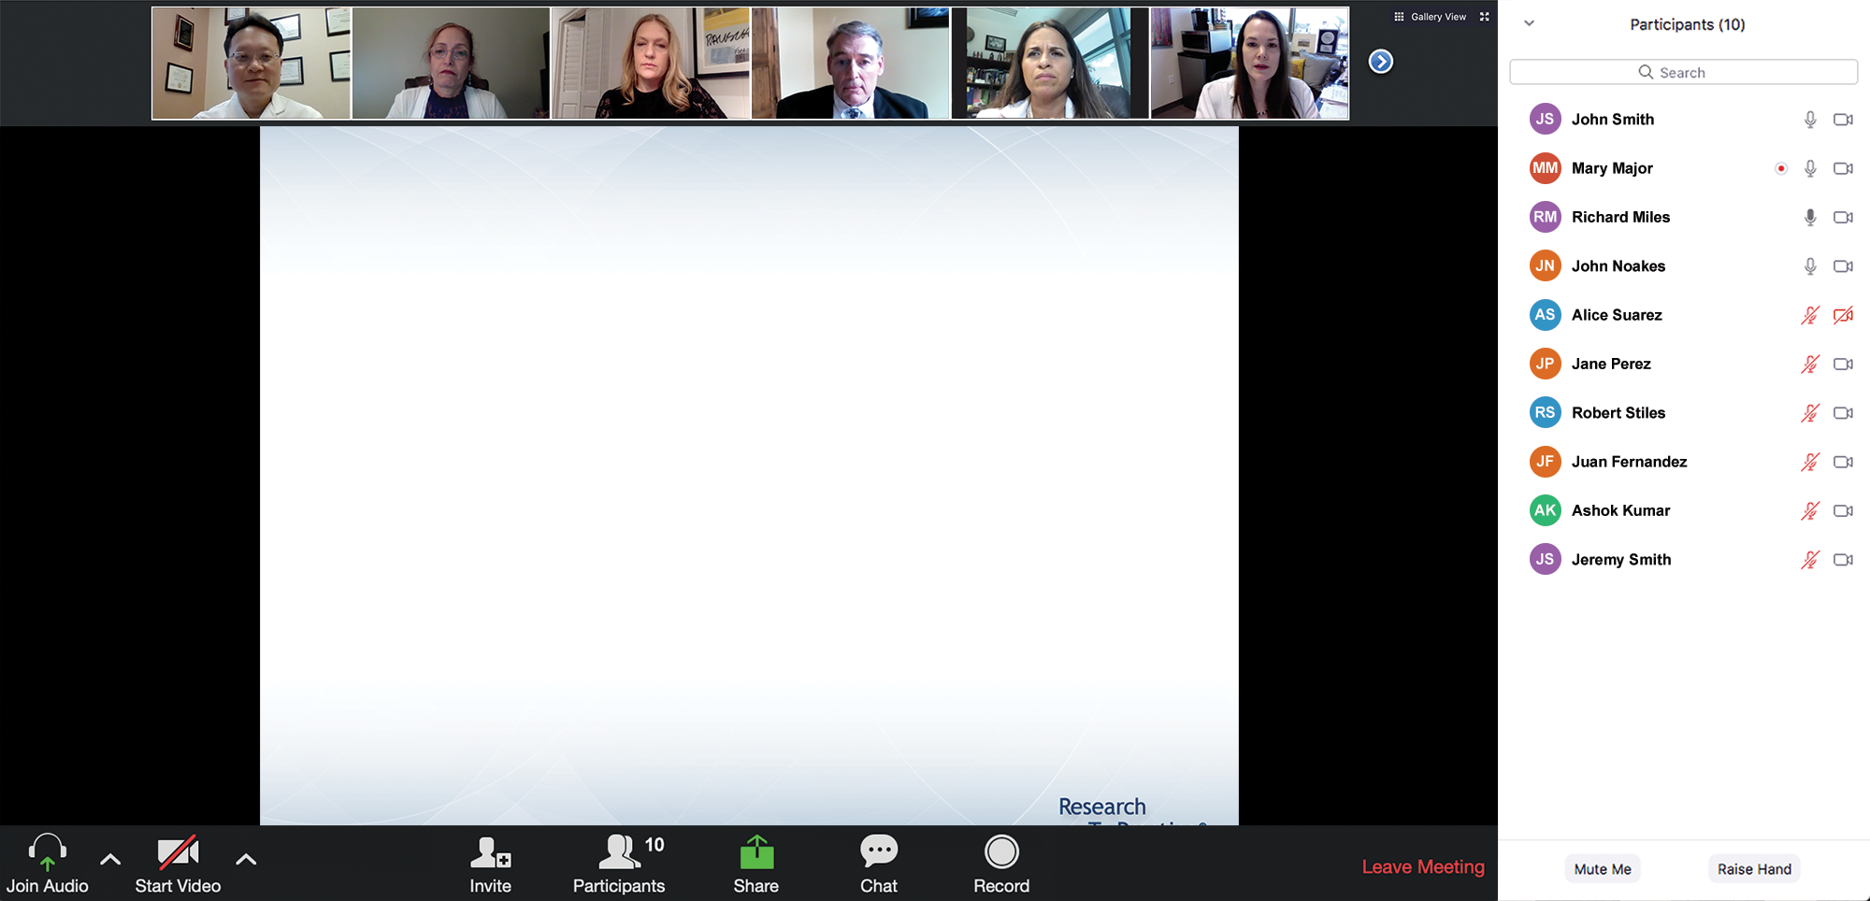

We Encourage Clinicians in Practice to Submit Questions
Feel free to submit questions now before the program begins and throughout the program.

Slide 9
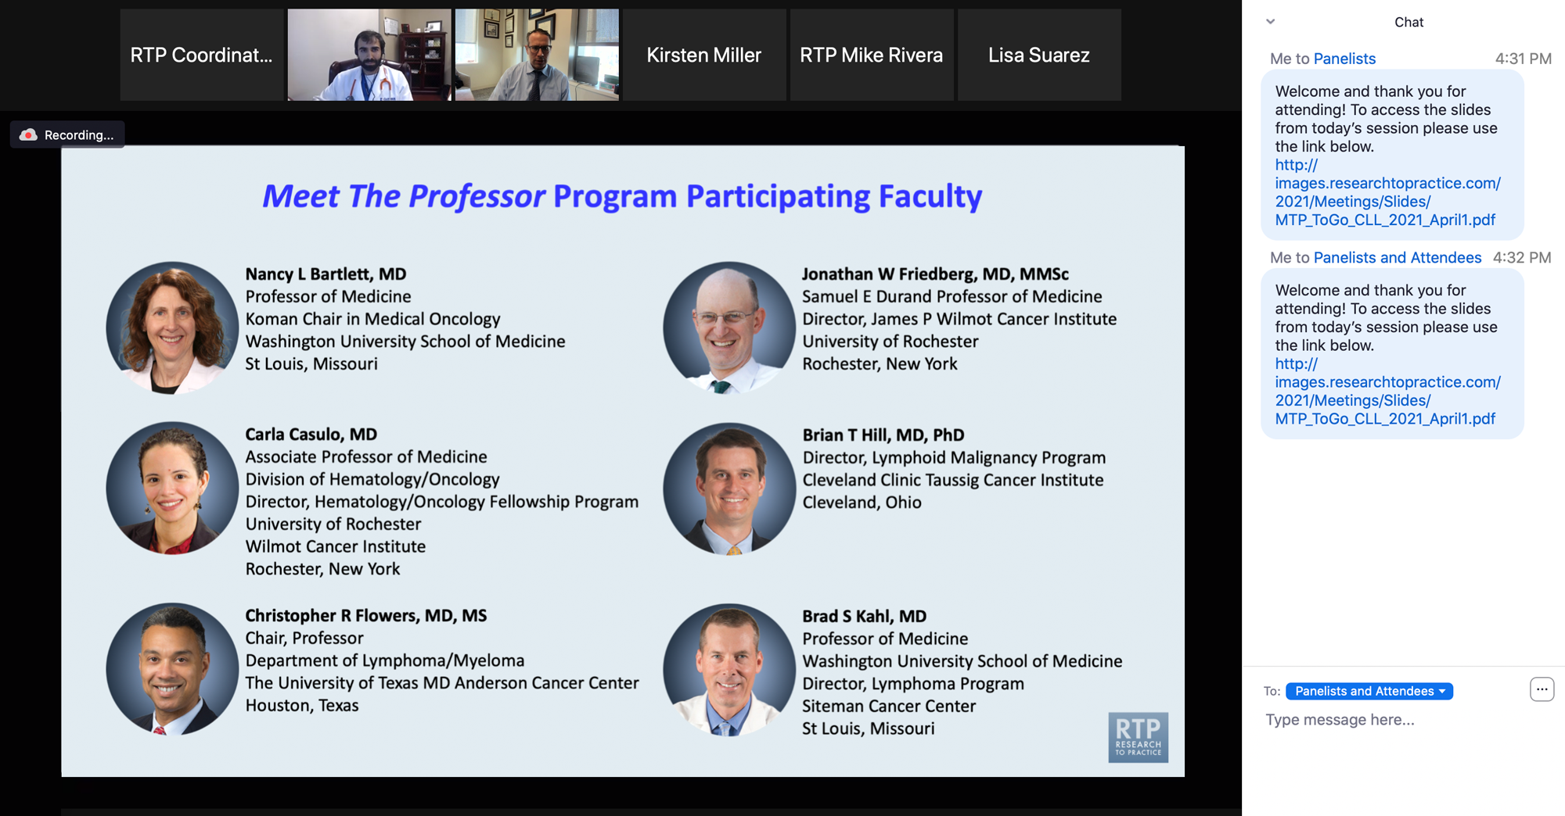
Familiarizing Yourself with the Zoom Interface
Expand chat submission box
Drag the white line above the submission box up to create
more space for your message.

Slide 10
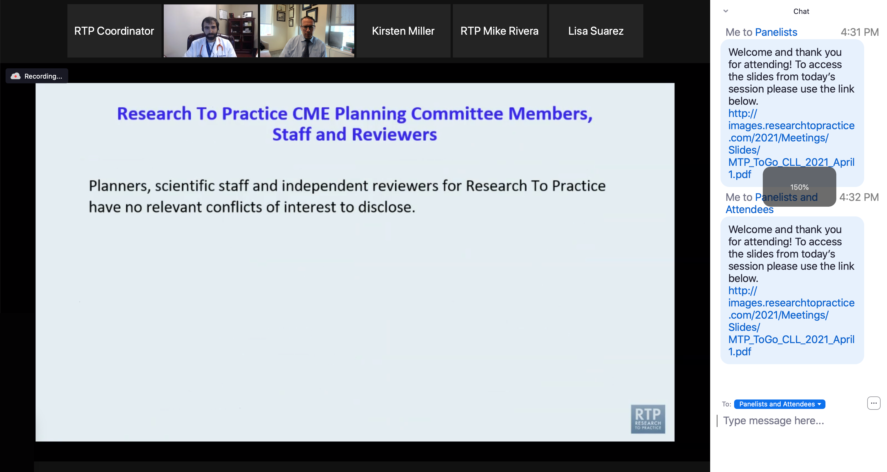
Familiarizing Yourself with the Zoom Interface
Increase chat font size
Press Command (for Mac) or Control (for PC) and the + symbol.
You may do this as many times as you need for readability.

Slide 11
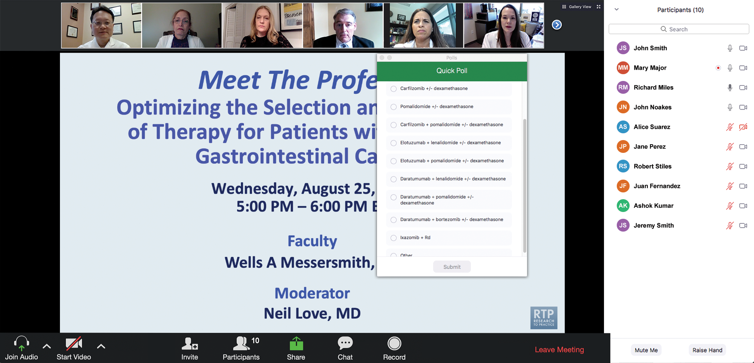
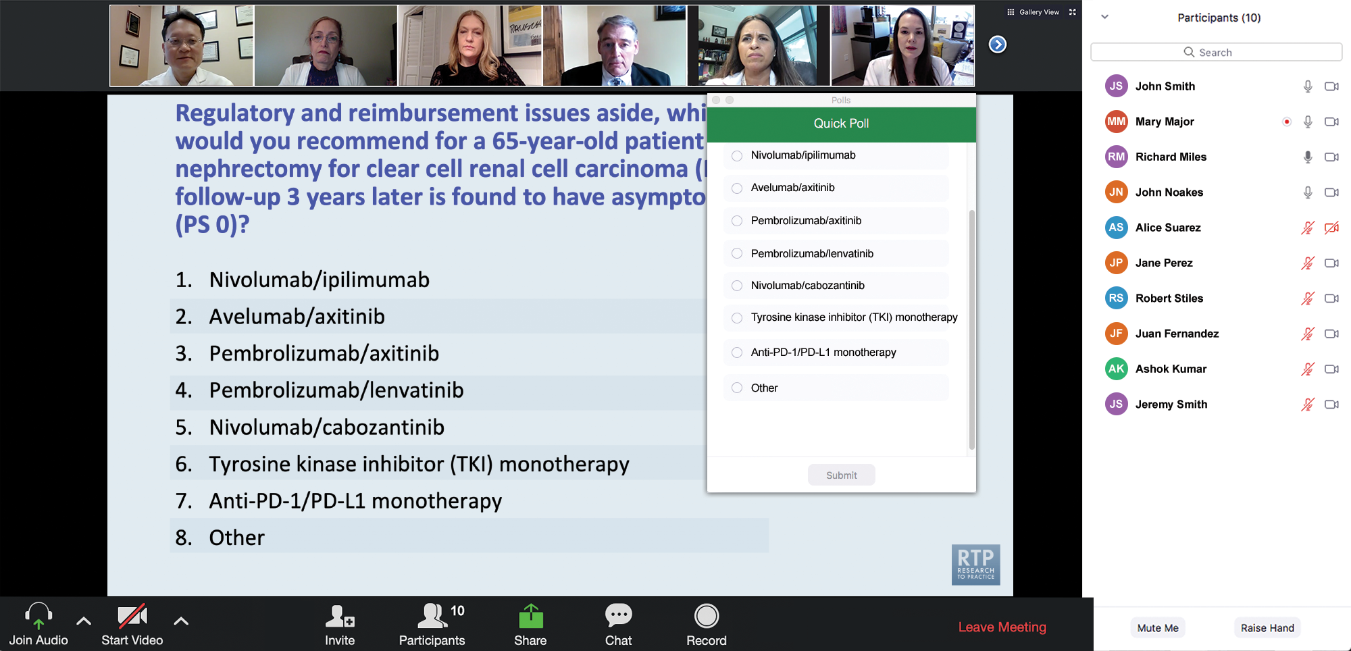
Clinicians in the Audience, Please Complete the Pre- and Postmeeting Surveys
Quick Survey
Quick Poll

Slide 12
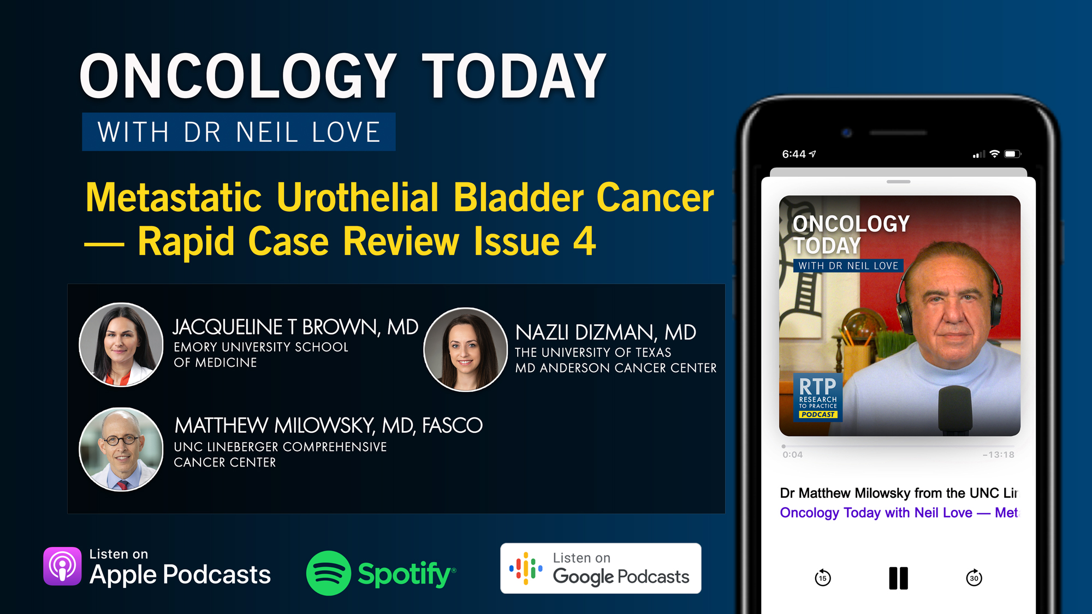

Slide 13
Year in Review: Clinical Investigator Perspectives on the
Most Relevant New Datasets and Advances in Oncology
Localized HR-Positive Breast Cancer
A CME/MOC-Accredited Live Webinar
Wednesday, May 6, 2026
5:00 PM – 6:00 PM ET
Faculty
Harold J Burstein, MD, PhD
Joyce O’Shaughnessy, MD
Moderator
Neil Love, MD

Slide 14
Recent Advances in Cancer Care — New Paradigms,
Novel Agents and What It Means for the Oncology Nurse
A Complimentary NCPD Symposium Series Held During the 51st Annual ONS Congress May 13-16
San Antonio Marriott Rivercenter | San Antonio, Texas
Antibody-Drug Conjugates
Wednesday, May 13, 2026 | 11:15 AM – 12:45 PM CT
Prostate Cancer
Thursday, May 14, 2026 | 12:15 PM – 1:45 PM CT
Ovarian Cancer
Wednesday, May 13, 2026 | 6:00 PM – 7:30 PM CT
Non-Muscle-Invasive and
Muscle-Invasive Bladder Cancer
Thursday, May 14, 2026 | 6:00 PM – 7:30 PM CT
Endometrial Cancer
Thursday, May 14, 2026 | 6:00 AM – 7:30 AM CT
Pancreatic Cancer
Friday, May 15, 2026 | 6:00 AM – 7:30 AM CT

Slide 15
Recent Advances in Cancer Care — New Paradigms,
Novel Agents and What It Means for the Oncology Nurse
A Complimentary NCPD Symposium Series Held During the 51st Annual ONS Congress May 13-16
San Antonio Marriott Rivercenter | San Antonio, Texas
Targeting the PI3K/AKT/mTOR Pathway in
HR-Positive Metastatic Breast Cancer
Friday, May 15, 2026 | 12:15 PM – 1:45 PM CT
Relapsed/Refractory Multiple Myeloma
Saturday, May 16, 2026 | 12:15 PM – 1:45 PM CT
Non-Hodgkin Lymphoma and
Chronic Lymphocytic Leukemia
Friday, May 15, 2026 | 6:00 PM – 8:00 PM CT
Oral SERDs for Breast Cancer
Saturday, May 16, 2026 | 6:00 PM – 7:30 PM CT
CDK4/6 Inhibitors for HR-Positive
Breast Cancer
Saturday, May 16, 2026 | 6:00 AM – 7:30 AM CT

Slide 16
Second Opinion: Investigators Provide Perspectives on the Current and Future Management of
Renal Cell Carcinoma and Prostate Cancer
A 2-Part CME Satellite Symposium Series Held in Conjunction with the
2026 American Urological Association Annual Meeting (AUA2026)
Renal Cell Carcinoma
Sunday, May 17, 2026
8:00 AM – 9:30 AM ET
Prostate Cancer
Sunday, May 17, 2026
5:30 PM – 7:30 PM ET

Slide 17
Research To Practice CME Symposia
Held in Conjunction with the 2026 ASCO® Annual Meeting
Hilton Chicago | 720 South Michigan Avenue | Chicago, Illinois
Friday, May 29, 2026
Chronic Lymphocytic Leukemia
6:30 PM – 8:30 PM CT (7:30 PM – 9:30 PM ET)
EGFR-Mutated Non-Small Cell Lung Cancer
6:30 PM – 8:30 PM CT (7:30 PM – 9:30 PM ET)
Saturday, May 30, 2026
Small Cell Lung Cancer
7:00 PM – 9:00 PM CT (8:00 PM – 10:00 PM ET)
Prostate Cancer
7:00 PM – 9:00 PM CT (8:00 PM – 10:00 PM ET)
Ovarian Cancer
7:00 PM – 9:00 PM CT (8:00 PM – 10:00 PM ET)

Slide 18
Research To Practice CME Symposia
Held in Conjunction with the 2026 ASCO® Annual Meeting
Hilton Chicago | 720 South Michigan Avenue | Chicago, Illinois
Sunday, May 31, 2026
Targeting the PI3K/AKT/mTOR
Pathway in Breast Cancer
7:00 PM – 9:00 PM CT (8:00 PM – 10:00 PM ET)
Endometrial Cancer
7:00 PM – 8:30 PM CT (8:00 PM – 9:30 PM ET)
CAR T-Cell Therapy and Bispecific
Antibodies for Non-Hodgkin Lymphoma
7:00 PM – 9:00 PM CT (8:00 PM – 10:00 PM ET)
Monday, June 1, 2026
ADCs for Breast Cancer
7:00 PM – 9:00 PM CT (8:00 PM – 10:00 PM ET)

Slide 19
Grand Rounds
CME/MOC-Accredited Interactive Series
Regional Activities
Three Series
Optimizing Treatment
for Patients with Relapsed/Refractory Chronic Lymphocytic Leukemia
Optimizing the Use of
Novel Therapies for Patients with Diffuse
Large B-Cell Lymphoma
Optimizing Therapy for Patients with Hormone Receptor-Positive
Localized Breast Cancer
Host a 1-hour session at your institution:
Email Meetings@ResearchToPractice.com
or call (800) 233-6153

Slide 20
Year in Review:
Non-Muscle-Invasive and Muscle-Invasive Bladder Cancer
INTRODUCTION: Life After Radical Cystectomy
MODULE 1: Muscle-Invasive Bladder Cancer — Prof Powles
MODULE 2: Non-Muscle-Invasive Bladder Cancer — Dr Kamat

Slide 21
Year in Review: Clinical Investigator Perspectives on the
Most Relevant New Datasets and Advances in Oncology
Non-Muscle-Invasive and Muscle-Invasive
Urothelial Bladder Cancer
A CME/MOC-Accredited Live Webinar
Tuesday, May 5, 2026
5:00 PM – 6:00 PM ET
Faculty
Ashish M Kamat, MD, MBBS
Thomas Powles, MBBS, MRCP, MD
Moderator
Neil Love, MD

Slide 22
Faculty
Ashish M Kamat, MD, MBBS
Professor of Urologic Oncology (Surgery)
Wayne B Duddlesten Professor of Cancer Research
Department of Urology, Division of Surgery
The University of Texas
MD Anderson Cancer Center
Houston, Texas
MODERATOR
Neil Love, MD
Research To Practice
Miami, Florida
Thomas Powles, MBBS, MRCP, MD
Director of Barts Cancer Institute
Queen Mary University of London
London, United Kingdom

Slide 23
We Encourage Clinicians in Practice to Submit Questions
Feel free to submit questions now before the program begins and throughout the program.

Slide 24
Clinicians in the Audience, Please Complete the Pre- and Postmeeting Surveys
Quick Survey
Quick Poll

Slide 26
Year in Review: Clinical Investigator Perspectives on the
Most Relevant New Datasets and Advances in Oncology
Localized HR-Positive Breast Cancer
A CME/MOC-Accredited Live Webinar
Wednesday, May 6, 2026
5:00 PM – 6:00 PM ET
Faculty
Harold J Burstein, MD, PhD
Joyce O’Shaughnessy, MD
Moderator
Neil Love, MD

Slide 27
Recent Advances in Cancer Care — New Paradigms,
Novel Agents and What It Means for the Oncology Nurse
A Complimentary NCPD Symposium Series Held During the 51st Annual ONS Congress May 13-16
San Antonio Marriott Rivercenter | San Antonio, Texas
Antibody-Drug Conjugates
Wednesday, May 13, 2026 | 11:15 AM – 12:45 PM CT
Prostate Cancer
Thursday, May 14, 2026 | 12:15 PM – 1:45 PM CT
Ovarian Cancer
Wednesday, May 13, 2026 | 6:00 PM – 7:30 PM CT
Non-Muscle-Invasive and
Muscle-Invasive Bladder Cancer
Thursday, May 14, 2026 | 6:00 PM – 7:30 PM CT
Endometrial Cancer
Thursday, May 14, 2026 | 6:00 AM – 7:30 AM CT
Pancreatic Cancer
Friday, May 15, 2026 | 6:00 AM – 7:30 AM CT

Slide 28
Recent Advances in Cancer Care — New Paradigms,
Novel Agents and What It Means for the Oncology Nurse
A Complimentary NCPD Symposium Series Held During the 51st Annual ONS Congress May 13-16
San Antonio Marriott Rivercenter | San Antonio, Texas
Targeting the PI3K/AKT/mTOR Pathway in
HR-Positive Metastatic Breast Cancer
Friday, May 15, 2026 | 12:15 PM – 1:45 PM CT
Relapsed/Refractory Multiple Myeloma
Saturday, May 16, 2026 | 12:15 PM – 1:45 PM CT
Non-Hodgkin Lymphoma and
Chronic Lymphocytic Leukemia
Friday, May 15, 2026 | 6:00 PM – 8:00 PM CT
Oral SERDs for Breast Cancer
Saturday, May 16, 2026 | 6:00 PM – 7:30 PM CT
CDK4/6 Inhibitors for HR-Positive
Breast Cancer
Saturday, May 16, 2026 | 6:00 AM – 7:30 AM CT

Slide 29
Second Opinion: Investigators Provide Perspectives on the Current and Future Management of
Renal Cell Carcinoma and Prostate Cancer
A 2-Part CME Satellite Symposium Series Held in Conjunction with the
2026 American Urological Association Annual Meeting (AUA2026)
Renal Cell Carcinoma
Sunday, May 17, 2026
8:00 AM – 9:30 AM ET
Prostate Cancer
Sunday, May 17, 2026
5:30 PM – 7:30 PM ET

Slide 30
Research To Practice CME Symposia
Held in Conjunction with the 2026 ASCO® Annual Meeting
Hilton Chicago | 720 South Michigan Avenue | Chicago, Illinois
Friday, May 29, 2026
Chronic Lymphocytic Leukemia
6:30 PM – 8:30 PM CT (7:30 PM – 9:30 PM ET)
EGFR-Mutated Non-Small Cell Lung Cancer
6:30 PM – 8:30 PM CT (7:30 PM – 9:30 PM ET)
Saturday, May 30, 2026
Small Cell Lung Cancer
7:00 PM – 9:00 PM CT (8:00 PM – 10:00 PM ET)
Prostate Cancer
7:00 PM – 9:00 PM CT (8:00 PM – 10:00 PM ET)
Ovarian Cancer
7:00 PM – 9:00 PM CT (8:00 PM – 10:00 PM ET)

Slide 31
Research To Practice CME Symposia
Held in Conjunction with the 2026 ASCO® Annual Meeting
Hilton Chicago | 720 South Michigan Avenue | Chicago, Illinois
Sunday, May 31, 2026
Targeting the PI3K/AKT/mTOR
Pathway in Breast Cancer
7:00 PM – 9:00 PM CT (8:00 PM – 10:00 PM ET)
Endometrial Cancer
7:00 PM – 8:30 PM CT (8:00 PM – 9:30 PM ET)
CAR T-Cell Therapy and Bispecific
Antibodies for Non-Hodgkin Lymphoma
7:00 PM – 9:00 PM CT (8:00 PM – 10:00 PM ET)
Monday, June 1, 2026
ADCs for Breast Cancer
7:00 PM – 9:00 PM CT (8:00 PM – 10:00 PM ET)

Slide 32
Grand Rounds
CME/MOC-Accredited Interactive Series
Regional Activities
Three Series
Optimizing Treatment
for Patients with Relapsed/Refractory Chronic Lymphocytic Leukemia
Optimizing the Use of
Novel Therapies for Patients with Diffuse
Large B-Cell Lymphoma
Optimizing Therapy for Patients with Hormone Receptor-Positive
Localized Breast Cancer
Host a 1-hour session at your institution:
Email Meetings@ResearchToPractice.com
or call (800) 233-6153

Slide 33
Year in Review: Clinical Investigator Perspectives on the
Most Relevant New Datasets and Advances in Oncology
Non-Muscle-Invasive and Muscle-Invasive
Urothelial Bladder Cancer
A CME/MOC-Accredited Live Webinar
Tuesday, May 5, 2026
5:00 PM – 6:00 PM ET
Faculty
Ashish M Kamat, MD, MBBS
Thomas Powles, MBBS, MRCP, MD
Moderator
Neil Love, MD

Slide 34
Commercial Support
This activity is supported by educational grants from Genentech, a member of the Roche Group, and Natera Inc.
Research To Practice CME Planning Committee Members,
Staff and Reviewers
Planners, scientific staff and independent reviewers for Research To Practice have no relevant financial relationships to disclose.

Slide 35
Dr Love — Disclosures
Dr Love is president and CEO of Research To Practice. Research To Practice receives funds in the form of educational grants to develop CME activities from the following companies: Aadi Bioscience, AbbVie Inc, ADC Therapeutics, Agendia Inc, Alexion Pharmaceuticals, Amgen Inc, Array BioPharma Inc, a subsidiary of Pfizer Inc, Arvinas, Astellas, AstraZeneca Pharmaceuticals LP, Aveo Pharmaceuticals, Bayer HealthCare Pharmaceuticals, BeOne, Biotheranostics Inc, A Hologic Company, Black Diamond Therapeutics Inc, Blueprint Medicines, Boehringer Ingelheim Pharmaceuticals Inc, Bristol Myers Squibb, Celcuity, Clovis Oncology, Coherus BioSciences, Corcept Therapeutics Inc, CTI BioPharma, a Sobi Company, Daiichi Sankyo Inc, Eisai Inc, Elevation Oncology Inc, Exact Sciences Corporation, Exelixis Inc, Genentech, a member of the Roche Group, Genmab US Inc, Geron Corporation, Gilead Sciences Inc, GSK, Helsinn Therapeutics (US) Inc, ImmunoGen Inc, Incyte Corporation, Ipsen Biopharmaceuticals Inc, Jazz Pharmaceuticals Inc, Johnson & Johnson, Karyopharm Therapeutics, Kite, A Gilead Company, Kura Oncology, Legend Biotech, Lilly, MEI Pharma Inc, Merck, Mersana Therapeutics Inc, Mirati Therapeutics Inc, Mural Oncology Inc, Natera Inc, Novartis, Novartis Pharmaceuticals Corporation on behalf of Advanced Accelerator Applications, Novocure Inc, Nuvalent, Nuvation Bio Inc, Pfizer Inc, Pharmacyclics LLC, an AbbVie Company, Puma Biotechnology Inc, Regeneron Pharmaceuticals Inc, Revolution Medicines Inc, Rigel Pharmaceuticals Inc, R-Pharm US, Sanofi, Seagen Inc, Servier Pharmaceuticals LLC, SpringWorks Therapeutics Inc, Stemline Therapeutics Inc, Sumitomo Pharma America, Summit Therapeutics, Syndax Pharmaceuticals, Taiho Oncology Inc, Takeda Pharmaceuticals USA Inc, TerSera Therapeutics LLC, and Tesaro, A GSK Company.

Slide 36
Dr Kamat — Disclosures
Advisory Committees and Consulting Agreements | Astellas, Atonco, Biological Dynamics, Bristol Myers Squibb, Carisma Therapeutics, CG Oncology, Cystotech, Eisai Inc, enGene, Ferring Pharmaceuticals, Genentech, a member of the Roche Group, Imagin Medical, ImmunityBio, Imvax Inc, Incyte Corporation, Janssen Biotech Inc, Medac, Merck, Nonagen Bioscience, Pfizer Inc, Photocure, Protara Therapeutics, Roche Laboratories Inc, Seagen Inc, Theralase, Urogen Pharma, US Biotest Inc, Valar Labs, Vivet Therapeutics
Patents | CyPRIT (Cytokine Predictors of Response to Intravesical Therapy) — Joint patent with MD Anderson Cancer Center # 00043705
Research Funding | Arquer Diagnostics, enGene, Ferring Pharmaceuticals Photocure, Seagen Inc
Nonrelevant Financial Relationships | American Urological Association (AUA), European Urology Oncology, International Bladder Cancer Group (IBCG), Journal of Urology, Patient-Centered Outcomes Research Institute (PCORI), SWOG, UroToday, World Bladder Cancer Patient Coalition

Slide 37
Prof Powles — Disclosures
Advisory Committees | Astellas, AstraZeneca Pharmaceuticals LP, Bristol Myers Squibb, Eisai Inc, Exelixis Inc, Incyte Corporation, Ipsen Biopharmaceuticals Inc, Johnson & Johnson, Merck Serono, MSD, Novartis, Pfizer Inc, Roche Laboratories Inc, Seagen Inc
Consulting Agreements | Astellas, AstraZeneca Pharmaceuticals LP, Bristol Myers Squibb, Eisai Inc, Exelixis Inc, Ipsen Biopharmaceuticals Inc, Johnson & Johnson, Merck Serono, MSD, Novartis, Pfizer Inc, Roche Laboratories Inc, Seagen Inc
Nonrelevant Financial Relationships | Mashup Media LLC

Slide 38
This educational activity contains discussion of
non-FDA-approved uses of agents and regimens. Please refer to official prescribing information for each product for approved indications.

Slide 39
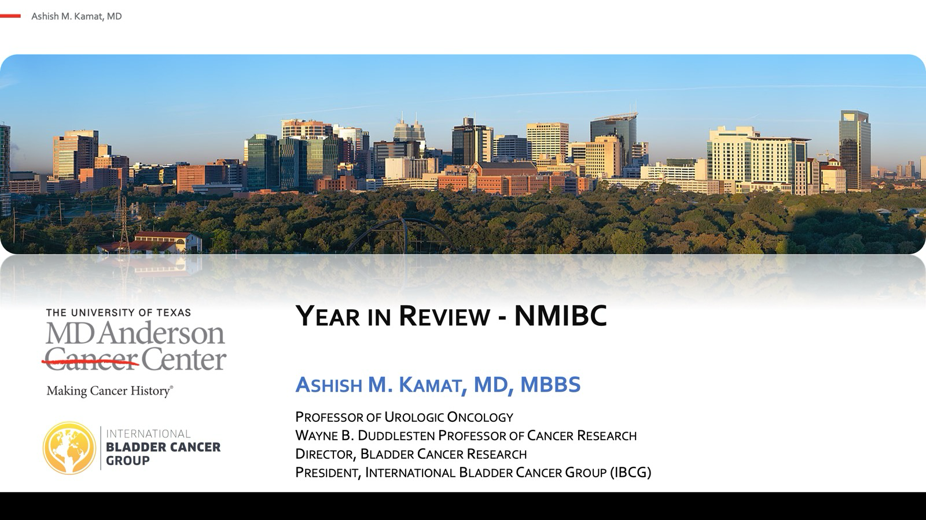


Slide 40
Key Datasets
Ashish Kamat, MD, MBBS
Shore ND et al. Sasanlimab plus BCG in BCG-naive, high-risk non-muscle invasive bladder cancer: The randomized phase 3 CREST trial. Nat Med 2025;31(8):2806-14.
De Santis M et al. Durvalumab in combination with BCG for BCG-naive, high-risk, non-muscle-invasive bladder cancer (POTOMAC): Final analysis of a randomised, open-label, phase 3 trial. Lancet 2025;406(10516):2221-34.
Rouprêt M et al. ALBAN (GETUG-AFU 37): A phase III, randomized, open-label international trial of intravenous atezolizumab and intravesical bacillus Calmette-Guerin (BCG) versus BCG alone in BCG-naive high-risk, non-muscle-invasive bladder cancer (NMIBC). Ann Oncol 2026;37(1):44-52.
Hayne D et al. Mitomycin plus BCG as adjuvant intravesical therapy for high-risk, non–muscle-invasive bladder cancer: A randomized phase 3 trial (ANZUP 1301). ASCO 2025;Abstract LBA4504.
Daneshmand S et al. TAR-200 for bacillus Calmette-Guerin-unresponsive high-risk non-muscle-invasive bladder cancer: Results from the phase IIb SunRISe-1 study. J Clin Oncol 2025;43(33):3578-88.

Slide 41
Key Datasets
Ashish Kamat, MD, MBBS (continued)
Jacob JM et al. TAR-200 monotherapy in patients with bacillus Calmette-Guérin-unresponsive high-risk non–muscle-invasive bladder cancer carcinoma in situ: 1-year durability and patient-reported outcomes from SUNRISE-1. AUA 2025.
Guerrero-Ramos F et al. TAR-200 monotherapy in patients with bacillus Calmette-Guérin–unresponsive papillary disease–only high-risk non–muscle-invasive bladder cancer: First results from cohort 4 of SUNRISE-1. AUA 2025.
Daneshmand S et al. Erdafitinib in patients with high- and intermediate-risk non-muscle-invasive bladder cancer: Final analysis of THOR-2 Study. Eur Urol 2026;89(2):165-73.
Chang SS et al. Prolonged progression-free survival, disease-free survival, and cystectomy avoidance with IL-15 receptor lymphocyte-stimulating agent NAI plus bacillus Calmette-Guerin in bacillus Calmette-Guerin-unresponsive papillary-only nonmuscle-invasive bladder cancer. J Urol 2026;215(1):44-56.
Wang B et al. Real-world experience with a commercial circulating tumor dna assay in non-muscle-invasive bladder cancer. Eur Urol Oncol 2025 August;8(4):883-7.

Slide 42
Key Datasets
Thomas Powles, MBBS, MRCP, MD
Meeks JJ et al. The first report of disease-free survival analyses from the NIAGARA trial of perioperative durvalumab plus neoadjuvant chemotherapy in muscle-invasive bladder cancer. AUA 2025;Abstract PD37-09.
Powles T et al. Circulating tumor DNA (ctDNA) in patients with muscle-invasive bladder cancer (MIBC) who received perioperative durvalumab (D) in NIAGARA. ASCO 2025;Abstract 4503.
Van der Heijden MS et al. Urinary tumor DNA (utDNA) and circulating tumor DNA (ctDNA) in patients (pts) with muscle-invasive bladder cancer (MIBC) who received perioperative durvalumab (D) in NIAGARA. Genitourinary Cancers Symposium 2026;Abstract 636.
Vulsteke C et al. Perioperative enfortumab vedotin and pembrolizumab in bladder cancer. N Engl J Med 2026 April 2;394(13):1257-69.
Galsky M et al. Neoadjuvant and adjuvant enfortumab vedotin (EV) plus pembrolizumab (pembro) for participants with muscle-invasive bladder cancer (MIBC) who are eligible for cisplatin: Randomized, open-label, phase 3 KEYNOTE-B15 study. Genitourinary Cancers Symposium 2026;Abstract LBA630.

Slide 43
Key Datasets
Thomas Powles, MBBS, MRCP, MD (continued)
Powles TB et al. ctDNA-Guided adjuvant atezolizumab in muscle-invasive bladder cancer. N Engl J Med 2025;393(24):2395-408.
Bellmunt J et al. Circulating tumor (ct)DNA-guided adjuvant atezolizumab (atezo) in muscle-invasive bladder cancer (MIBC): Exploratory analysis of ctDNA dynamics in the IMvigor011 trial. Genitourinary Cancers Symposium 2026;Abstract 633.
Ghatalia P et al. Circulating tumor DNA (ctDNA) to guide response-adapted bladder preservation in muscle invasive bladder cancer (MIBC): Integrated analysis of the RETAIN trials. Genitourinary Cancers Symposium 2026;Abstract LBA632.
Mellema JJ et al. Ipilimumab and nivolumab followed by chemoradiotherapy as bladder-sparing treatment in muscle-invasive bladder cancer: A phase 2 trial. Nat Med 2026;[Online ahead of print].
Galsky MD et al. Adjuvant nivolumab versus placebo for high-risk muscle-invasive urothelial carcinoma: 5-year efficacy and ctDNA results from CheckMate 274. Ann Oncol 2026;37(1):69-78.

Slide 44
Year in Review:
Non-Muscle-Invasive and Muscle-Invasive Bladder Cancer
INTRODUCTION: Life After Radical Cystectomy
MODULE 1: Muscle-Invasive Bladder Cancer — Prof Powles
MODULE 2: Non-Muscle-Invasive Bladder Cancer — Dr Kamat

Slide 45
Year in Review:
Non-Muscle-Invasive and Muscle-Invasive Bladder Cancer
INTRODUCTION: Life After Radical Cystectomy
MODULE 1: Muscle-Invasive Bladder Cancer — Prof Powles
MODULE 2: Non-Muscle-Invasive Bladder Cancer — Dr Kamat

Slide 46
Year in Review:
Non-Muscle-Invasive and Muscle-Invasive Bladder Cancer
INTRODUCTION: Life After Radical Cystectomy
MODULE 1: Muscle-Invasive Bladder Cancer — Prof Powles
IMvigor011, CheckMate 274
NIAGARA ctDNA analysis
Perioperative enfortumab vedotin with pembrolizumab
Bladder-sparing approaches
MODULE 2: Non-Muscle-Invasive Bladder Cancer — Dr Kamat

Slide 47
Select Key Datasets
IMvigor011, CheckMate 274
Powles TB et al. ctDNA-guided adjuvant atezolizumab in muscle-invasive bladder cancer. N Engl J Med 2025;393(24):2395-408.
Bellmunt J et al. Circulating tumor (ct)DNA-guided adjuvant atezolizumab (atezo) in muscle-invasive bladder cancer (MIBC): Exploratory analysis of ctDNA dynamics in the IMvigor011 trial. Genitourinary Cancers Symposium 2026;Abstract 633.
Galsky MD et al. Adjuvant nivolumab versus placebo for high-risk muscle-invasive urothelial carcinoma: 5-year efficacy and ctDNA results from CheckMate 274. Ann Oncol 2026;37(1):69-78.

Slide 48
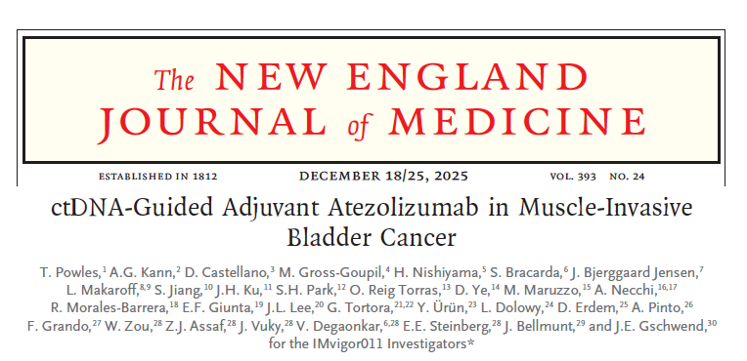
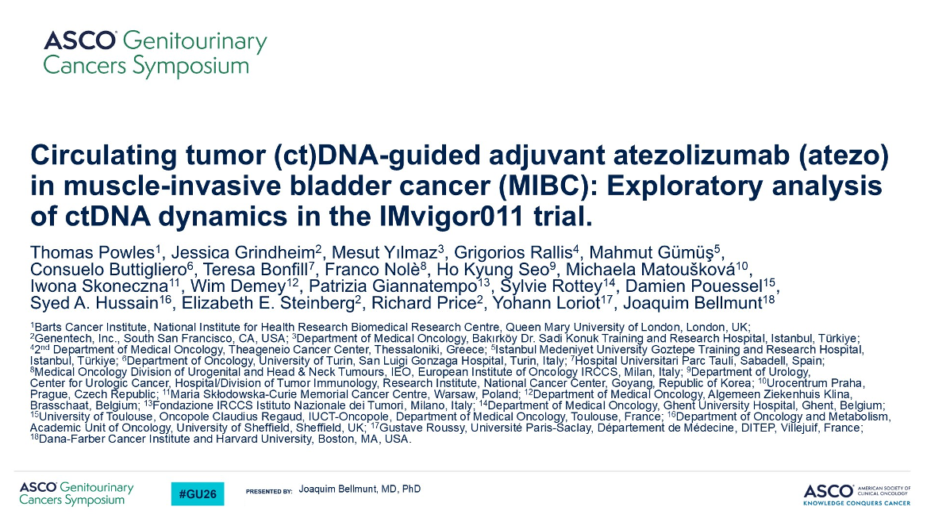
Abstract 633

Slide 49
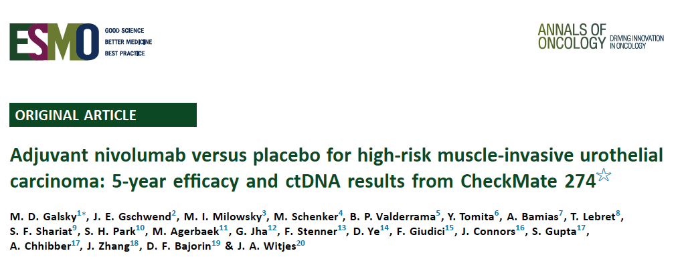
2026;37(1):69-78.

Slide 50
SUMMARY
ctDNA is a prognostic and predictive tool in the adjuvant setting
It can help select patients for adjuvant therapy in immune therapy naive patients
The levels as well as positive vs negative status are relevant
EVP in perioperative disease is the standard making these data less relevant
Courtesy of Thomas Powles, MBBS, MRCP, MD

Slide 51
Select Key Datasets
NIAGARA ctDNA Analysis
Meeks JJ et al. The first report of disease-free survival analyses from the NIAGARA trial of perioperative durvalumab plus neoadjuvant chemotherapy in muscle-invasive bladder cancer. AUA 2025;Abstract PD37-09.
Powles T et al. Circulating tumor DNA (ctDNA) in patients with muscle-invasive bladder cancer (MIBC) who received perioperative durvalumab (D) in NIAGARA. ASCO 2025;Abstract 4503.
Van der Heijden MS et al. Urinary tumor DNA (utDNA) and circulating tumor DNA (ctDNA) in patients (pts) with muscle-invasive bladder cancer (MIBC) who received perioperative durvalumab (D) in NIAGARA. Genitourinary Cancers Symposium 2026;Abstract 636.

Slide 52
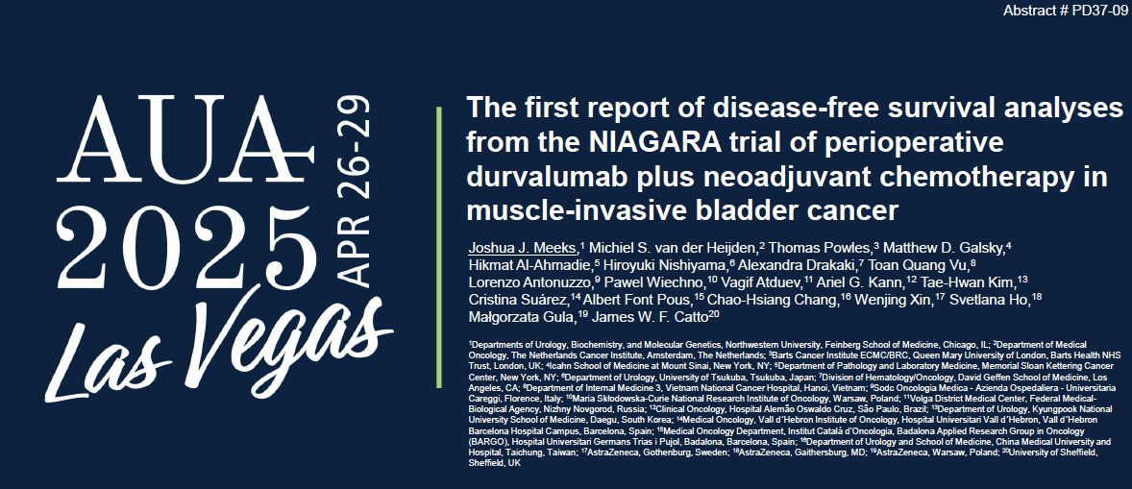

Slide 53
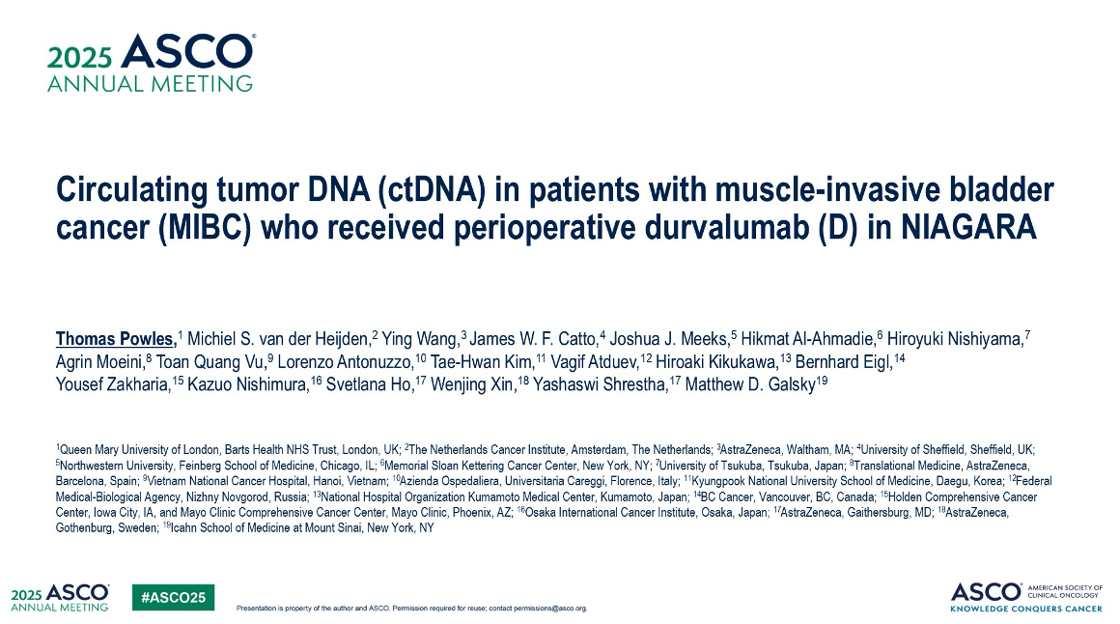
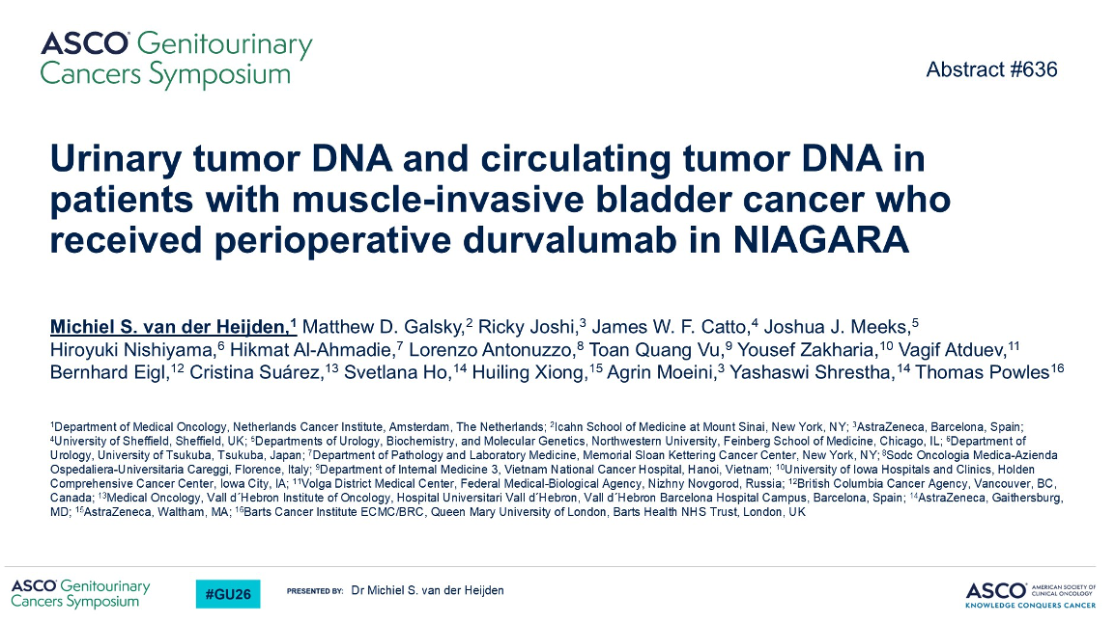
Abstract 4503

Slide 54
SUMMARY
ctDNA in the neoadjuvant therapy is strongly prognostic
Failure to clear ctDNA with therapy is incresasingly bad news
ctDNA is not able to tell us when to stop immune therapy early
utDNA may improve accuracy of the cancer status in the bladder
Courtesy of Thomas Powles, MBBS, MRCP, MD

Slide 55
Select Key Datasets
Perioperative Enfortumab Vedotin with Pembrolizumab
Vulsteke C et al. Perioperative enfortumab vedotin and pembrolizumab in bladder cancer. N Engl J Med 2026 April 2;394(13):1257-69.
Galsky M et al. Neoadjuvant and adjuvant enfortumab vedotin (EV) plus pembrolizumab (pembro) for participants with muscle-invasive bladder cancer (MIBC) who are eligible for cisplatin: Randomized, open-label, phase 3 KEYNOTE-B15 study. Genitourinary Cancers Symposium 2026;Abstract LBA630.

Slide 56
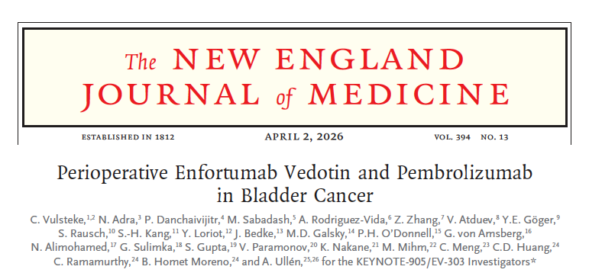
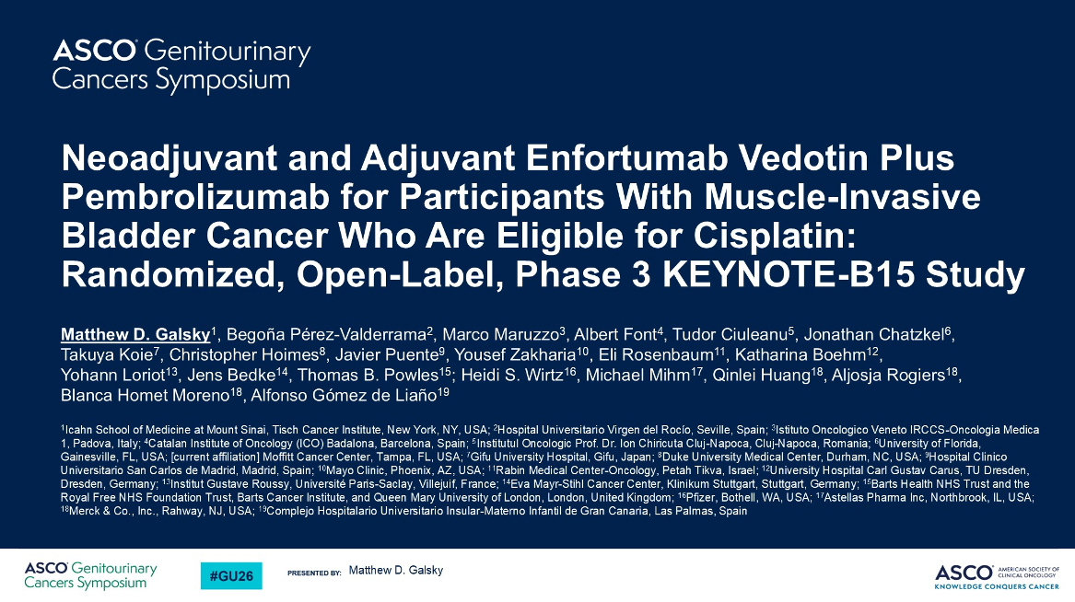
Abstract LBA630

Slide 57
SUMMARY
ADC/immune checkpoint combinations are standard 1st line therapy for UC (M1 and MIBC)
Early immune therapy saves lives in MIBC
Duration of therapy and biomarker development are the next important steps
EVP in perioperative disease is the standard too. Platinum chemotherapy is the next treatment option.
“Enfortumab vedotin and pembrolizumab first, and ask questions later.” is probably where this ends
Courtesy of Thomas Powles, MBBS, MRCP, MD

Slide 58
Select Key Datasets
Bladder-Sparing Approaches
Mellema JJ et al. Ipilimumab and nivolumab followed by chemoradiotherapy as bladder-sparing treatment in muscle-invasive bladder cancer: A phase 2 trial. Nat Med 2026;[Online ahead of print].
Ghatalia P et al. Circulating tumor DNA (ctDNA) to guide response-adapted bladder preservation in muscle invasive bladder cancer (MIBC): Integrated analysis of the RETAIN trials. Genitourinary Cancers Symposium 2026;Abstract LBA632.

Slide 59
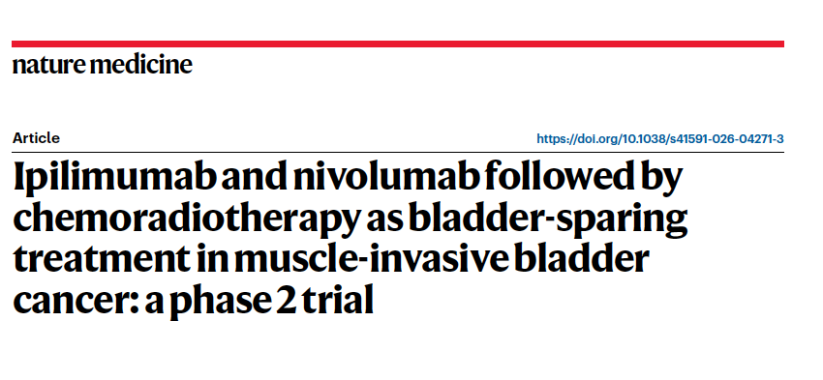
Mellema JJ et al. Nat Med 2026;[Online ahead of print].

Slide 60
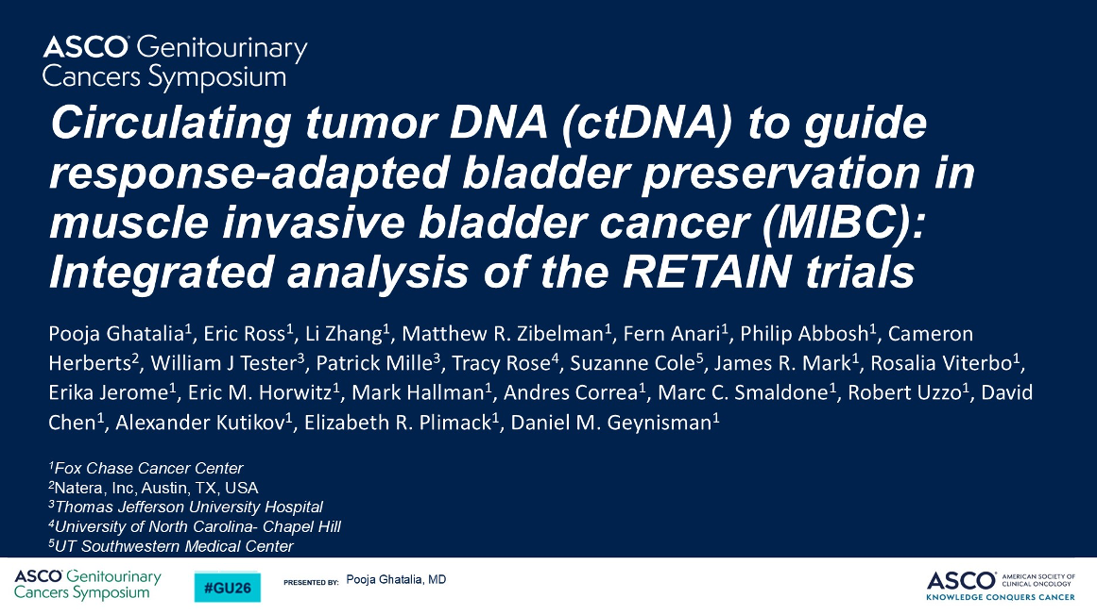
Abstract LBA632

Slide 61
SUMMARY
Bladder sparing approaches are increasingly important in MIBC
Systemic therapy alone may be enough for some with MIBC
A lot more data is needed
ctDNA is not great at identification of NMIBC post systemic therapy
Courtesy of Thomas Powles, MBBS, MRCP, MD

Slide 62
Year in Review:
Non-Muscle-Invasive and Muscle-Invasive Bladder Cancer
INTRODUCTION: Life After Radical Cystectomy
MODULE 1: Muscle-Invasive Bladder Cancer — Prof Powles
MODULE 2: Non-Muscle-Invasive Bladder Cancer — Dr Kamat
BCG with immunotherapy
TAR-200
Erdafitinib in NMIBC
Nogapendekin-alfa inbakicept
ctDNA monitoring for NMIBC

Slide 63
Select Key Datasets
BCG with Immunotherapy
Shore ND et al. Sasanlimab plus BCG in BCG-naive, high-risk non-muscle invasive bladder cancer: The randomized phase 3 CREST trial. Nat Med 2025;31(8):2806-14.
De Santis M et al. Durvalumab in combination with BCG for BCG-naive, high-risk, non-muscle-invasive bladder cancer (POTOMAC): Final analysis of a randomised, open-label, phase 3 trial. Lancet 2025;406(10516):2221-34.
Rouprêt M et al. ALBAN (GETUG-AFU 37): A phase III, randomized, open-label international trial of intravenous atezolizumab and intravesical bacillus Calmette-Guerin (BCG) versus BCG alone in BCG-naive high-risk, non-muscle-invasive bladder cancer (NMIBC). Ann Oncol 2026;37(1):44-52.

Slide 64
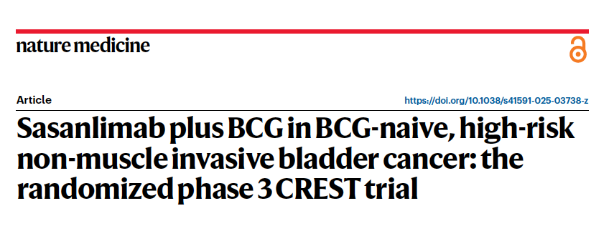
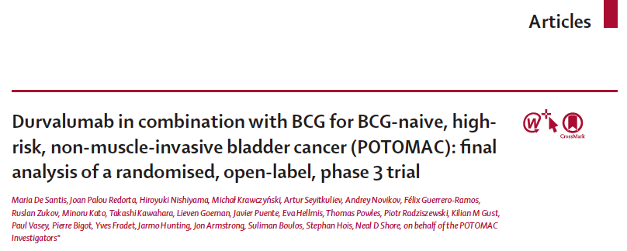
Shore ND et al. Nat Med 2025;31(8):2806-14.
Lancet 2025;406(10516):2221-34.

Slide 65
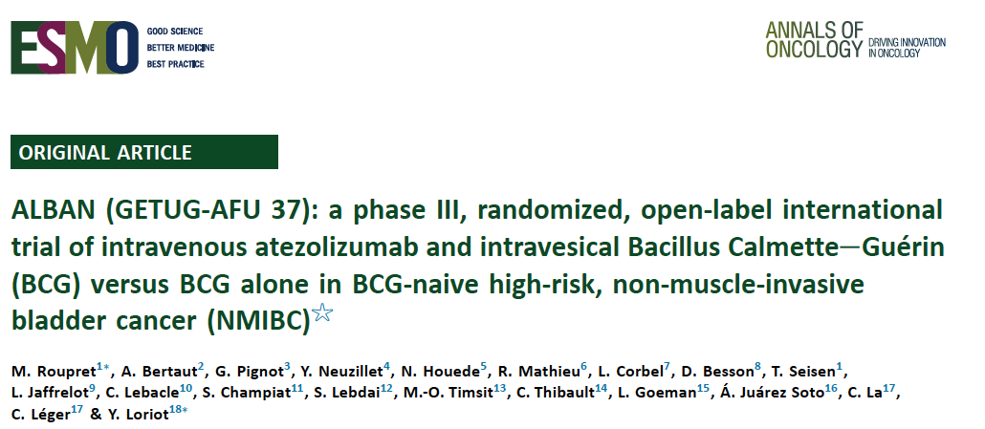
Ann Oncol 2026;37(1):44-52.

Slide 66
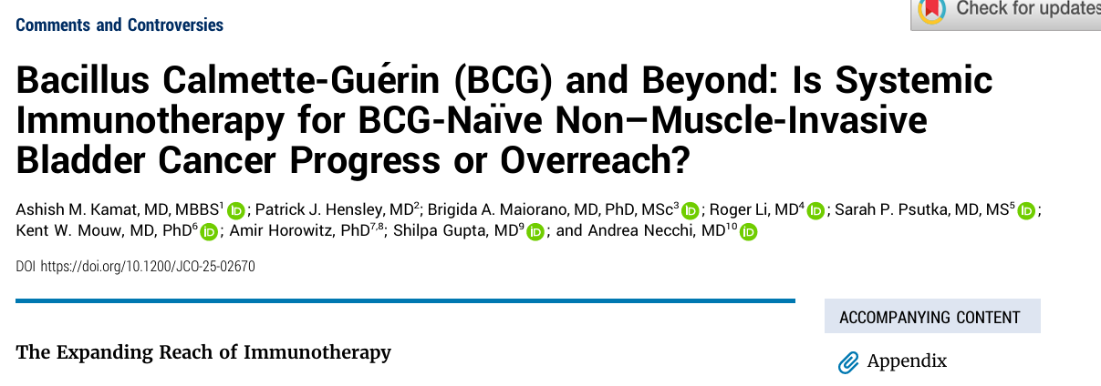
Ashish M. Kamat, MD
MY PERSPECTIVE
CREST & POTOMAC
Both CREST & POTOMAC are robustly positive Phase 3 trials — HR 0.68 for EFS in the largest BCG-naive HR-NMIBC trial to date (N=1,055)
The 7.3% - 5.4% absolute EFS improvement at 36 months matters when framed correctly
The maintenance lesson is now confirmed in two independent Phase 3 trials: BCG maintenance is mandatory for checkpoint inhibition to work — Arm B (induction only, HR 1.16) provides zero benefit and must not be adopted
The 5-fold increase in grade 3-4 toxicity (29.1% and 21%) with no OS benefit yet demands an honest risk-benefit discussion — we cannot recommend routine adoption until survival data mature
OS data remain immature — the defining unanswered question across all checkpoint+BCG trials; we are prescribing 2 years of systemic immunotherapy based on DFS alone, and survival benefit must ultimately be demonstrated

Slide 67
Select Key Datasets
TAR-200
Daneshmand S et al. TAR-200 for bacillus Calmette-Guerin-unresponsive high-risk non-muscle-invasive bladder cancer: Results from the phase IIb SunRISe-1 study. J Clin Oncol 2025;43(33):3578-88.
Jacob JM et al. TAR-200 monotherapy in patients with bacillus Calmette-Guérin-unresponsive high-risk non–muscle-invasive bladder cancer carcinoma in situ: 1-year durability and patient-reported outcomes from SUNRISE-1. AUA 2025.
Guerrero-Ramos F et al. TAR-200 monotherapy in patients with bacillus Calmette-Guérin–unresponsive papillary disease–only high-risk non–muscle-invasive bladder cancer: First results from cohort 4 of SUNRISE-1. AUA 2025.

Slide 68
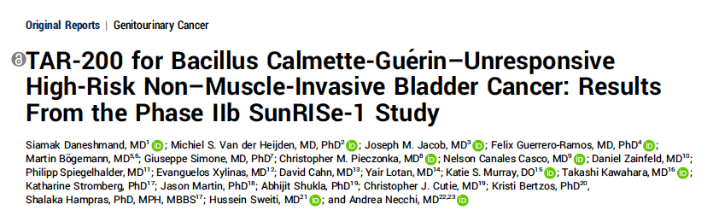
J Clin Oncol 2025;43(33):3578-88.

Slide 69
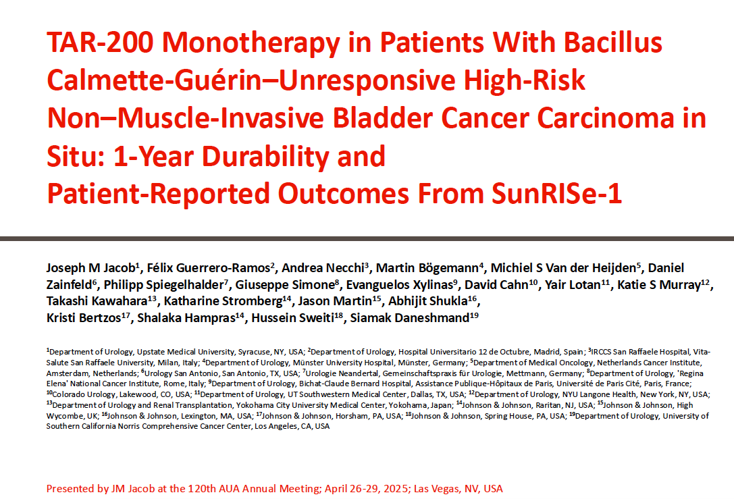
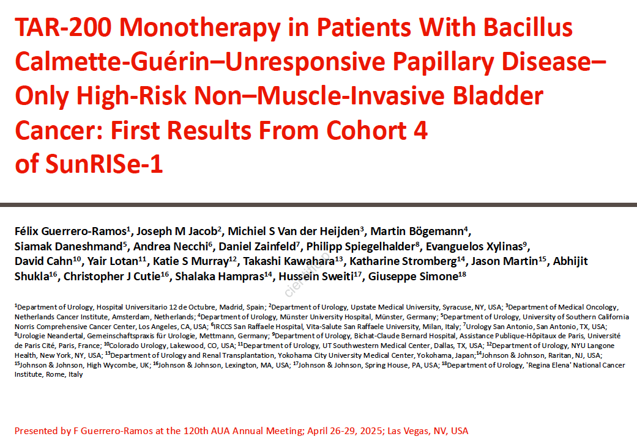

Slide 70
Ashish M. Kamat, MD
MY PERSPECTIVE
TAR-200 (SunRISe-1 C2) — Highest CR Rate to Date in BCG-Unresponsive CIS
An 82.4% complete response rate in BCG-unresponsive CIS - exceeds every currently approved and investigational option in this setting, achieved without reinduction
  25.8-month median DOR and 86.6% cystectomy-free rate at 12 months
Robust activity in papillary only disease
  Across the spectrum – Ta and T1
NO REINDUCTION ALLOWED in SunRISe studies
Safety is exceptional: grade ≥3 toxicity ~13%, predominantly LUTS-driven and self-limited; no systemic immunotoxicity
Phase 3 SunRISe-5 will be definitive; pending those results, TAR-200 is already the most promising bladder-preserving option in BCG-unresponsive CIS HR-NMIBC

Slide 71
Select Key Datasets
Erdafitinib in NMIBC
Daneshmand S et al. Erdafitinib in patients with high- and intermediate-risk non-muscle-invasive bladder cancer: Final analysis of THOR-2 Study. Eur Urol 2026;89(2):165-73.

Slide 72
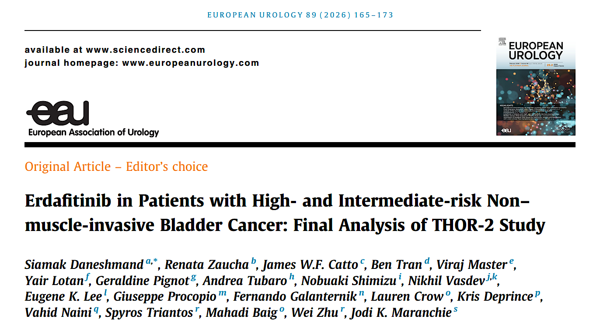

Slide 73
Ashish M. Kamat, MD
MY PERSPECTIVE
THOR-2 — Erdafitinib in FGFR-Altered NMIBC
Proof-of-concept that oral FGFR inhibition can deliver clinically meaningful activity in NMIBC, a first for a systemic agent in this space
The RFS hazard ratio of 0.28 in Cohort 1 is biologically compelling
Premature closure due to poor accrual limits interpretation but does not negate the signal
FGFR molecular testing must become part of routine NMIBC workup
  34% detection rate
  This trial validates precision oncology as a viable and necessary strategy
A completed randomized trial is required; the premature closure leaves an evidence gap the field must resolve to enable regulatory approval and practice change

Slide 74
Select Key Datasets
Nogapendekin-alfa Inbakicept
Chang SS et al. Prolonged progression-free survival, disease-free survival, and cystectomy avoidance with IL-15 receptor lymphocyte-stimulating agent NAI plus bacillus Calmette-Guerin in bacillus Calmette-Guerin-unresponsive papillary-only nonmuscle-invasive bladder cancer. J Urol 2026;215(1):44-56.

Slide 75
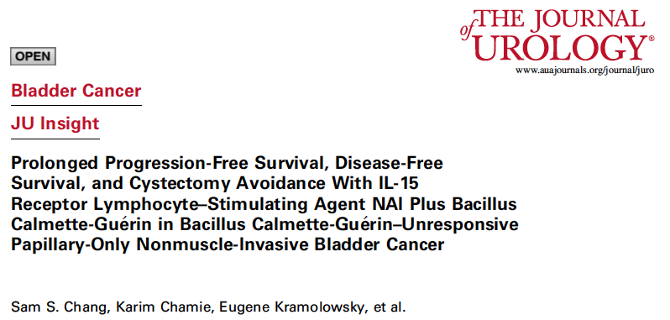
J Clin Oncol 2025;43(33):3578-88.

Slide 76
Ashish M. Kamat, MD
MY PERSPECTIVE
Nogapendekin + BCG in BCG-Unresponsive Papillary NMIBC — Filling a Critical Gap
No approved treatments exist for BCG-unresponsive papillary-only HR-NMIBC
NAI+BCG : 58.2% 12-month DFS rate that is competitive with other investigational approaches
  The declining DFS curve (58% → 38%, 12 to 36 months) is concerning and expected
The 92.2% cystectomy-free rate at 12 months and 96% disease-specific survival at 36 months are the numbers that matter most clinically
Safety is favorable : 61% grade 1-2 TRAEs, only 3% grade 3, no grade 4/5 events; this is a well-tolerated combination that integrates readily into clinical practice
Single-arm design limits definitive conclusions
  A randomized trial with an active comparator (intravesical chemotherapy) is needed to establish the incremental value of NAI+BCG over alternatives in this setting

Slide 77
Select Key Datasets ctDNA Monitoring for NMIBC
Wang B et al. Real-world experience with a commercial circulating tumor DNA assay in non-muscle-invasive bladder cancer. Eur Urol Oncol 2025 August; 8(4):883-7.

Slide 78
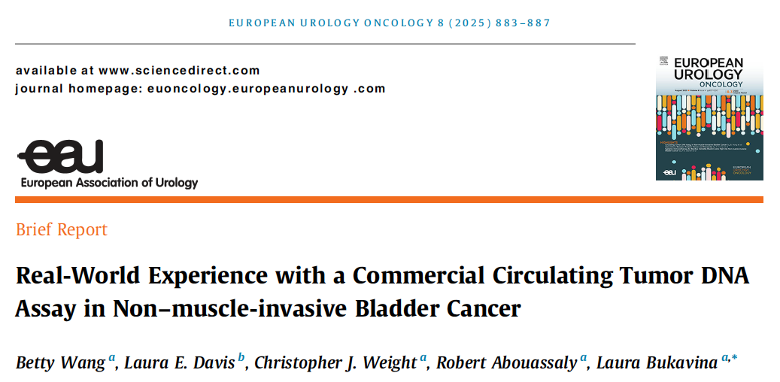

Slide 79
Ashish M. Kamat, MD
MY PERSPECTIVE
ctDNA Monitoring in NMIBC - Validation Urgently Needed
Proof-of-concept :
Case 19 (occult cT4N1 disease): ctDNA prompted staging that changed treatment from intravesical to systemic
Case 22 (early T2b detection): demonstrates that ctDNA can identify progression weeks before the next scheduled cystoscopy
The false-positive case is equally instructive: without clinical correlation and validated cutoffs, ctDNA results can drive unnecessary procedures and profound patient anxiety
I am enthusiastic about ctDNA in NMIBC but the field is not ready for routine clinical adoption
We must not over-react to positive signals
  The community must design prospective trials with pre-specified clinical decision algorithms and patient outcomes as benchmarks - detectability alone is not sufficient to justify routine use

Slide 80
Year in Review: Clinical Investigator Perspectives on the
Most Relevant New Datasets and Advances in Oncology
Localized HR-Positive Breast Cancer
A CME/MOC-Accredited Live Webinar
Wednesday, May 6, 2026
5:00 PM – 6:00 PM ET
Faculty
Harold J Burstein, MD, PhD
Joyce O’Shaughnessy, MD
Moderator
Neil Love, MD

Slide 81
Thank you for joining us!
Please take a moment to complete the survey currently up on Zoom. Your feedback is very important to us. The survey will remain open for 5 minutes after the meeting ends.
Information on how to obtain CME, ABIM MOC and ABS credit is provided in the Zoom chat room.
Attendees will also receive an email in
1 to 3 business days with these instructions.

Slide 82
APPENDIX

Slide 83
Select Key Datasets
BCG with Mitomycin
Hayne D et al. Mitomycin plus BCG as adjuvant intravesical therapy for high-risk, non–muscle-invasive bladder cancer: A randomized phase 3 trial (ANZUP 1301). ASCO 2025;Abstract LBA4504.

Slide 84
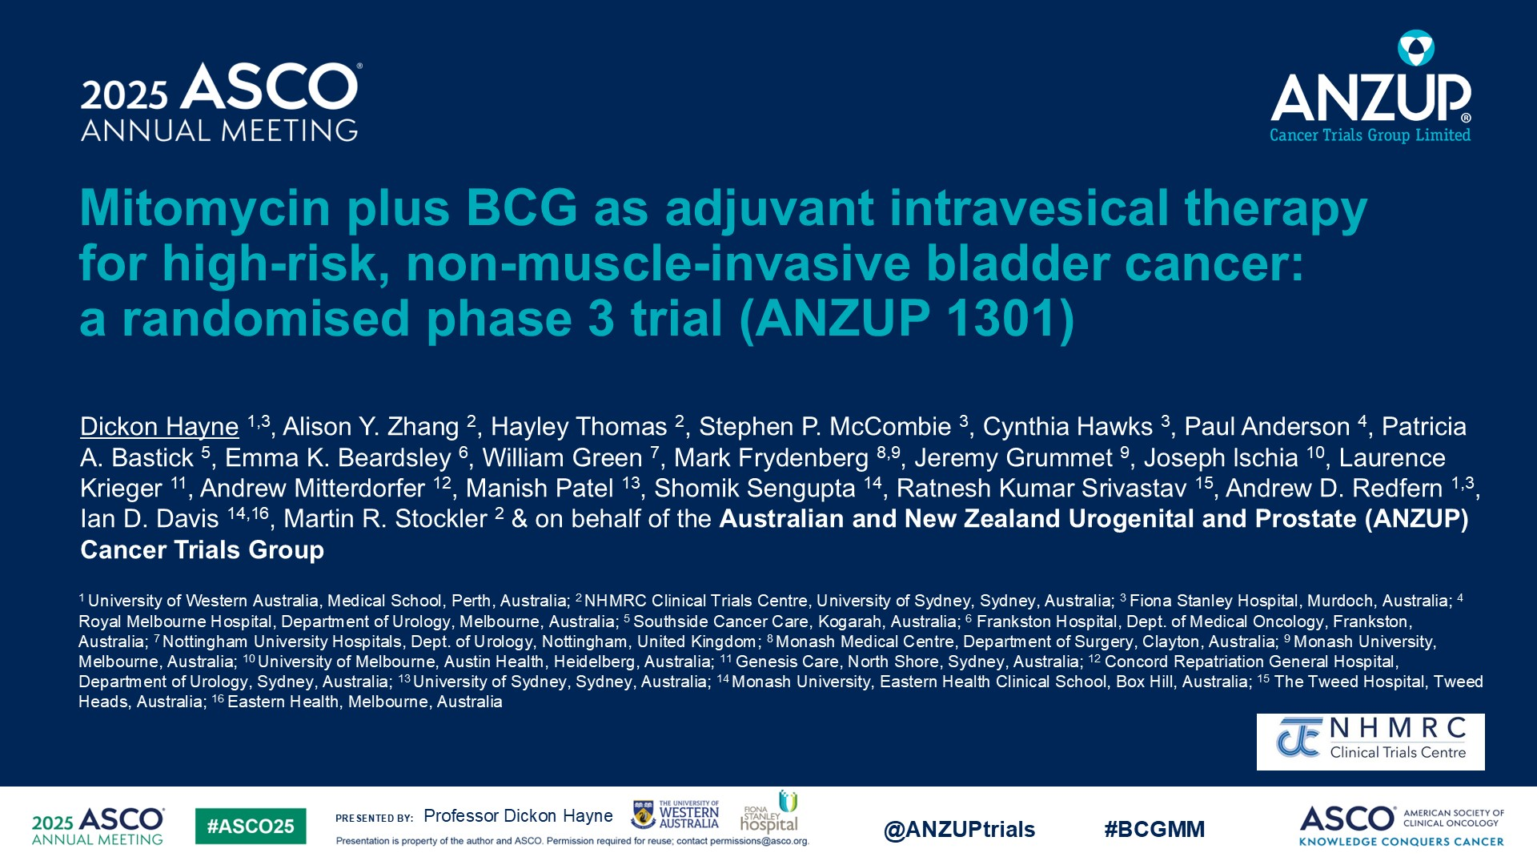

Slide 85
Ashish M. Kamat, MD
MY PERSPECTIVE
BCG + Mitomycin — Negative Primary Endpoint With a Signal Worth Pursuing in Selected Patients
A negative primary endpoint - BCG+MM does not improve DFS over BCG alone in unselected HR-NMIBC (HR 0.87, p=0.34);
The subgroup interaction is compelling: in higher-risk patients (all T1 or any CIS), HR is 0.69 with a significant interaction p-value (0.043) - a meaningful signal in the population at greatest risk of progression
Equally critical: BCG+MM may be inferior in lower-risk HG Ta patients (HR 1.28)
BCG+MM across all HR-NMIBC is not just unsupported; it could cause harm in the lower-risk group
My perspective: do not adopt BCG+MM universally; consider it selectively in T1 or CIS disease and where there is BCG shortage

