Slide 1
Where We Are, Where We’re Headed:
Bispecific Antibodies in the
Management of Follicular Lymphoma
A CME/MOC-Accredited Live Webinar
Thursday, October 22, 2026
5:00 PM – 6:00 PM ET
Faculty
Professor Chan Cheah, MBBS (Hons), DMSc
Matthew Matasar, MD
Moderator
Neil Love, MD

Slide 2
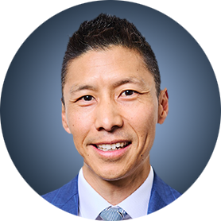
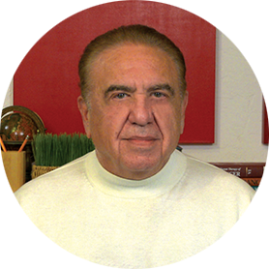

Faculty
Professor Chan Cheah, MBBS (Hons), DMSc
Clinical Professor of Medicine
Consultant Haematologist
Sir Charles Gairdner Hospital
Perth, Australia
MODERATOR
Neil Love, MD
Research To Practice
Miami, Florida
Matthew Matasar, MD
Chief, Division of Blood Disorders
Rutgers Cancer Institute
Hematologist/Oncologist
Professor
Rutgers Robert Wood Johnson Medical School
New Brunswick, New Jersey

Slide 3
Commercial Support
This activity is supported by an educational grant from AstraZeneca Pharmaceuticals LP.

Slide 4
Dr Love — Disclosures
Dr Love is president and CEO of Research To Practice. Research To Practice receives funds in the form of educational grants to develop CME activities from the following companies: Aadi Bioscience, AbbVie Inc, ADC Therapeutics, Agendia Inc, Alexion Pharmaceuticals, Amgen Inc, Array BioPharma Inc, a subsidiary of Pfizer Inc, Arvinas, Astellas, AstraZeneca Pharmaceuticals LP, Aveo Pharmaceuticals, Bayer HealthCare Pharmaceuticals, BeOne, Biotheranostics Inc, A Hologic Company, Black Diamond Therapeutics Inc, Blueprint Medicines, Boehringer Ingelheim Pharmaceuticals Inc, Bristol Myers Squibb, Catalyst Pharmaceuticals Inc, Celcuity, Clovis Oncology, Coherus BioSciences, Corcept Therapeutics Inc, CTI BioPharma, a Sobi Company, Daiichi Sankyo Inc, Eisai Inc, Elevation Oncology Inc, Exact Sciences Corporation, Exelixis Inc, Genentech, a member of the Roche Group, Genmab US Inc, Geron Corporation, Gilead Sciences Inc, GSK, Helsinn Therapeutics (US) Inc, ImmunoGen Inc, Incyte Corporation, Ipsen Biopharmaceuticals Inc, Jazz Pharmaceuticals Inc, Johnson & Johnson, Karyopharm Therapeutics, Kite, A Gilead Company, Kura Oncology, Legend Biotech, Lilly, MEI Pharma Inc, Merck, Mersana Therapeutics Inc, Mirati Therapeutics Inc, Mural Oncology Inc, Natera Inc, Novartis, Novartis Pharmaceuticals Corporation on behalf of Advanced Accelerator Applications, Novocure Inc, Nuvalent, Nuvation Bio Inc, Pfizer Inc, Pharmacyclics LLC, an AbbVie Company, Puma Biotechnology Inc, Regeneron Pharmaceuticals Inc, Revolution Medicines Inc, Rigel Pharmaceuticals Inc, R-Pharm US, Sanofi, Seagen Inc, Servier Pharmaceuticals LLC, SpringWorks Therapeutics Inc, Stemline Therapeutics Inc, Sumitomo Pharma America, Summit Therapeutics, Syndax Pharmaceuticals, Taiho Oncology Inc, Takeda Pharmaceuticals USA Inc, TerSera Therapeutics LLC, Tesaro, A GSK Company, and Verastem Inc.

Slide 5
Research To Practice CME Planning Committee Members,
Staff and Reviewers
Planners, scientific staff and independent reviewers for Research To Practice have no relevant financial relationships to disclose.

Slide 6
Prof Cheah — Disclosures
Advisory Committees | AbbVie Inc, AstraZeneca Pharmaceuticals LP, Roche Laboratories Inc
Consulting Agreements and Speakers Bureaus | AstraZeneca Pharmaceuticals LP
Data and Safety Monitoring Boards/ Committees | AstraZeneca Pharmaceuticals LP, Regeneron Pharmaceuticals Inc

Slide 7
Dr Matasar — Disclosures
Advisory Committees and Consulting Agreements | AbbVie Inc, Allogene Therapeutics, Arvinas, Genentech, a member of the Roche Group, Genmab US Inc, Incyte Corporation, Merck, Novartis, Pfizer Inc, Roche Laboratories Inc, Visionary Pharmaceuticals
Contracted Research | Bayer HealthCare Pharmaceuticals, Genentech, a member of the Roche Group, Johnson & Johnson, Pharmacyclics LLC, an AbbVie Company, Roche Laboratories Inc, Seagen Inc
Expert Testimony | Recursion
Stock Options/Stock — Public Companies | Merck
Nonrelevant Financial Relationships | Arnold & Porter Kaye Scholer LLP

Slide 8
This educational activity contains discussion of
non-FDA-approved uses of agents and regimens. Please refer to official prescribing information for each product for approved indications.

Slide 9
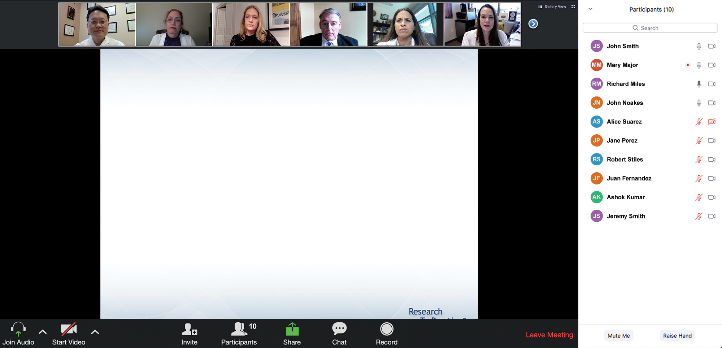
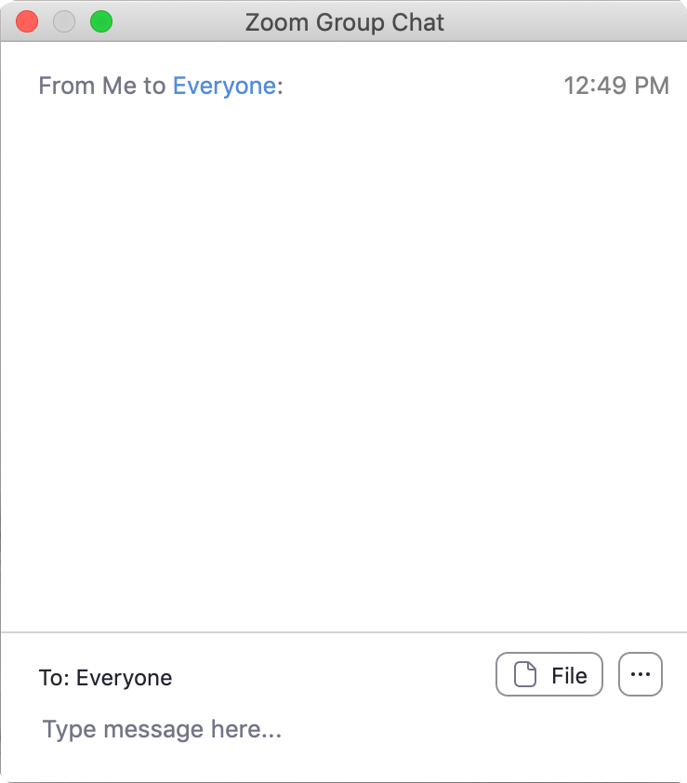
We Encourage Clinicians in Practice to Submit Questions
Feel free to submit questions now before the program begins and throughout the program.

Slide 10
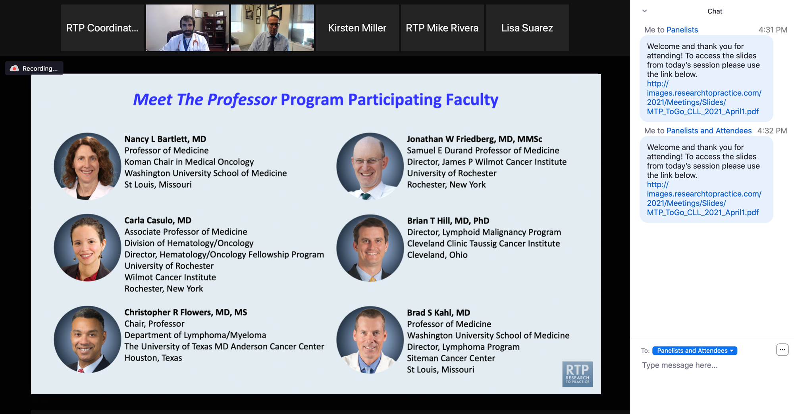
Familiarizing Yourself with the Zoom Interface
Expand chat submission box
Drag the white line above the submission box up to create
more space for your message.

Slide 11
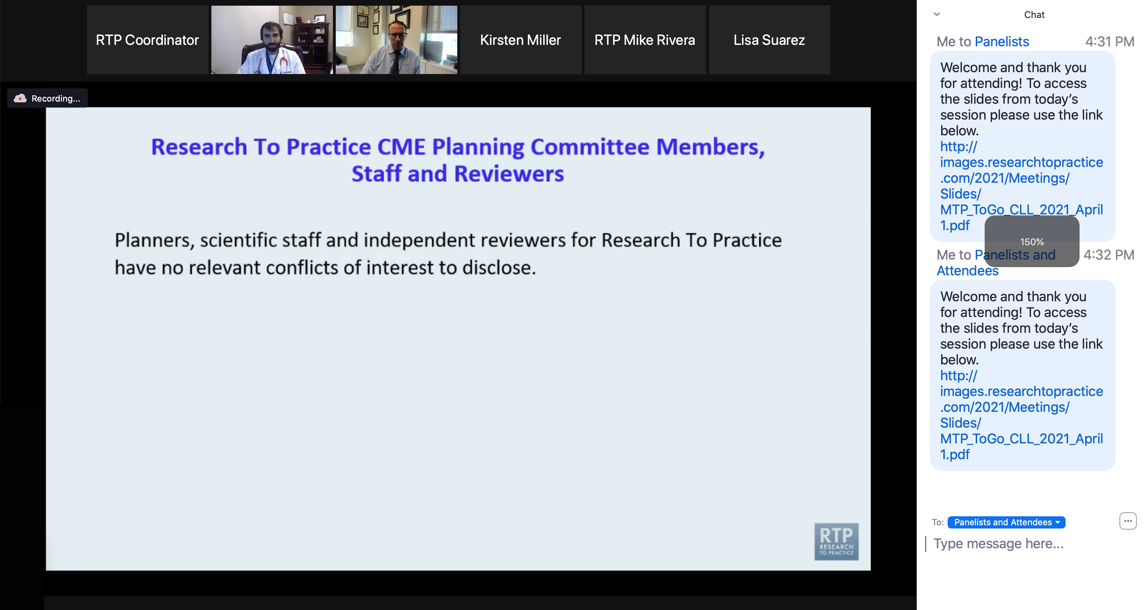
Familiarizing Yourself with the Zoom Interface
Increase chat font size
Press Command (for Mac) or Control (for PC) and the + symbol.
You may do this as many times as you need for readability.

Slide 12
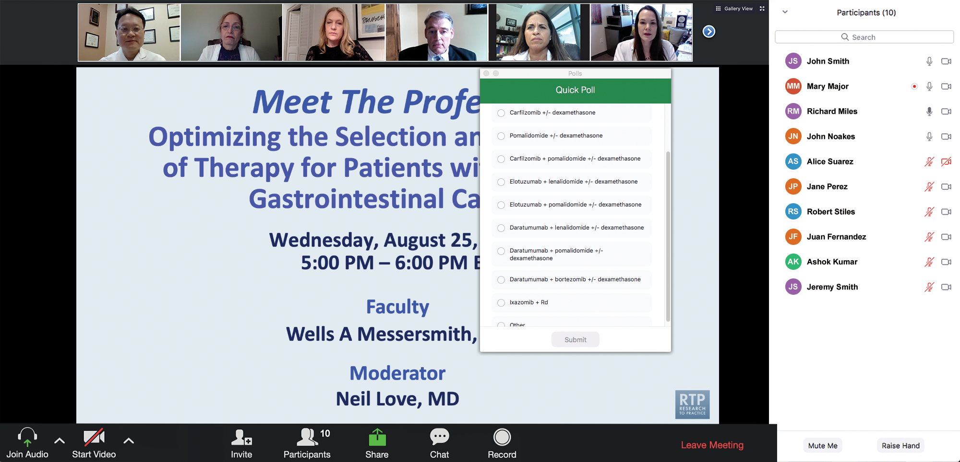
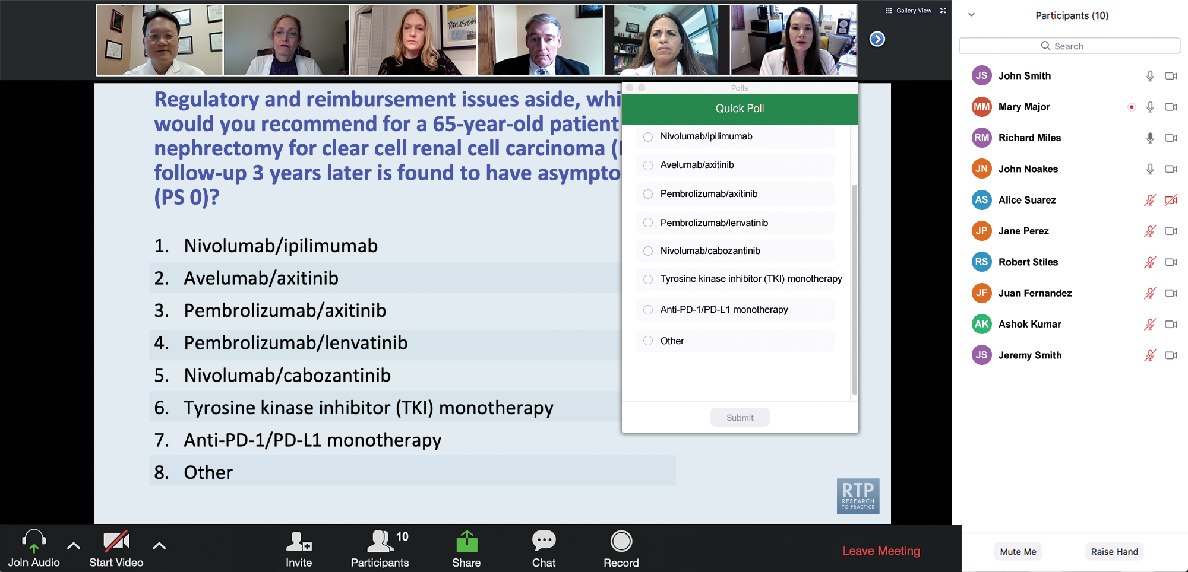
Clinicians in the Audience, Please Complete the Pre- and Postmeeting Surveys
Quick Survey
Quick Poll

Slide 13
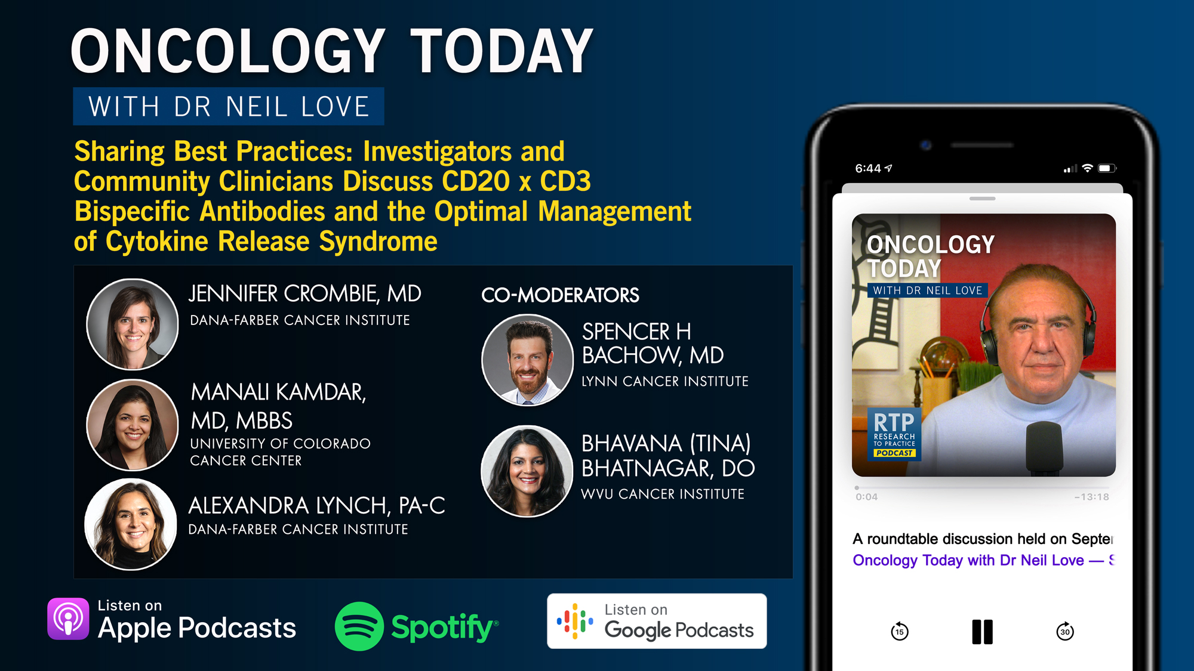

Slide 14
Cancer Conference Update:
ESMO Congress 2026 Review — Breast Cancer
A CME/MOC-Accredited Live Webinar
Thursday, November 12, 2026
5:00 PM – 6:30 PM ET
Faculty
Professor Giuseppe Curigliano, MD, PhD
Rebecca A Dent, MD, MSc
Komal Jhaveri, MD, FACP, FASCO
Moderator
Neil Love, MD

Slide 15
Second Opinion: A Case-Based Exploration of Clinical Investigator
Best Practices Related to the Management of Breast Cancer
A CME Satellite Symposium Series in San Antonio
HER2-Positive Breast Cancer
Tuesday, December 8, 2026
7:00 PM – 9:00 PM CT
Localized HR-Positive
Breast Cancer
Thursday, December 10, 2026
7:00 PM – 9:00 PM CT
PI3K/AKT/mTOR Inhibitors for HR-Positive Breast Cancer
Tuesday, December 8, 2026
7:00 PM – 9:00 PM CT
Oral SERDs for HR-Positive Breast Cancer
Thursday, December 10, 2026
7:00 PM – 9:00 PM CT
Triple-Negative Breast Cancer
Wednesday, December 9, 2026
7:00 PM – 9:00 PM CT

Slide 16
A Friday Satellite Symposium Series Preceding the 68th ASH Annual Meeting in New Orleans
Friday, December 11, 2026
Acute Myeloid Leukemia
7:30 AM – 9:30 AM CT
Myelofibrosis
3:15 PM – 5:15 PM CT
Chronic Lymphocytic Leukemia
7:30 AM – 9:30 AM CT
BCMA ADCs and Bispecific Antibodies for Multiple Myeloma
7:00 PM – 9:00 PM CT
Non-Hodgkin Lymphoma
11:30 AM – 1:30 PM CT
Novel Therapies for
Non-Hodgkin Lymphoma
7:00 PM – 9:00 PM CT
Multiple Myeloma
11:30 AM – 1:30 PM CT

Slide 17
Grand Rounds
CME/MOC-Accredited Interactive Series
Regional Activities
Four Series
Squamous Cell Carcinoma of the
Head and Neck
Gastroesophageal Cancers
Hormone-Sensitive Prostate Cancer
HER2-Positive
Breast Cancer
Host a 1-hour session at your institution:
Email Meetings@ResearchToPractice.com
or call (800) 233-6153

Slide 18

Save The Date
A Multitumor CME/MOC, NCPD- and ACPE-Accredited Educational Conference Developed in Partnership with Florida Cancer Specialists & Research Institute
Friday to Sunday, April 23 to 25, 2027
The Ritz-Carlton Orlando, Grande Lakes | Orlando, Florida
Moderated by Neil Love, MD

Slide 19
Thank you for joining us! Please take a moment to complete the survey currently up on Zoom.
Your feedback is very important to us.
Information on how to obtain CME and ABIM MOC credit will be provided at the conclusion of the activity in the Zoom chat room. Attendees will also receive an email in 1 to 3 business days with these instructions.

Slide 20
Where We Are, Where We’re Headed:
Bispecific Antibodies in the
Management of Follicular Lymphoma
A CME/MOC-Accredited Live Webinar
Thursday, October 22, 2026
5:00 PM – 6:00 PM ET
Faculty
Professor Chan Cheah, MBBS (Hons), DMSc
Matthew Matasar, MD
Moderator
Neil Love, MD

Slide 21
Faculty
Professor Chan Cheah, MBBS (Hons), DMSc
Clinical Professor of Medicine
Consultant Haematologist
Sir Charles Gairdner Hospital
Perth, Australia
MODERATOR
Neil Love, MD
Research To Practice
Miami, Florida
Matthew Matasar, MD
Chief, Division of Blood Disorders
Rutgers Cancer Institute
Hematologist/Oncologist
Professor
Rutgers Robert Wood Johnson Medical School
New Brunswick, New Jersey

Slide 22
We Encourage Clinicians in Practice to Submit Questions
Feel free to submit questions now before the program begins and throughout the program.

Slide 23
Clinicians in the Audience, Please Complete the Pre- and Postmeeting Surveys
Quick Survey
Quick Poll

Slide 25
Cancer Conference Update:
ESMO Congress 2026 Review — Breast Cancer
A CME/MOC-Accredited Live Webinar
Thursday, November 12, 2026
5:00 PM – 6:30 PM ET
Faculty
Professor Giuseppe Curigliano, MD, PhD
Rebecca A Dent, MD, MSc
Komal Jhaveri, MD, FACP, FASCO
Moderator
Neil Love, MD

Slide 26
Second Opinion: A Case-Based Exploration of Clinical Investigator
Best Practices Related to the Management of Breast Cancer
A CME Satellite Symposium Series in San Antonio
HER2-Positive Breast Cancer
Tuesday, December 8, 2026
7:00 PM – 9:00 PM CT
Localized HR-Positive
Breast Cancer
Thursday, December 10, 2026
7:00 PM – 9:00 PM CT
PI3K/AKT/mTOR Inhibitors for HR-Positive Breast Cancer
Tuesday, December 8, 2026
7:00 PM – 9:00 PM CT
Oral SERDs for HR-Positive Breast Cancer
Thursday, December 10, 2026
7:00 PM – 9:00 PM CT
Triple-Negative Breast Cancer
Wednesday, December 9, 2026
7:00 PM – 9:00 PM CT

Slide 27
A Friday Satellite Symposium Series Preceding the 68th ASH Annual Meeting in New Orleans
Friday, December 11, 2026
Acute Myeloid Leukemia
7:30 AM – 9:30 AM CT
Myelofibrosis
3:15 PM – 5:15 PM CT
Chronic Lymphocytic Leukemia
7:30 AM – 9:30 AM CT
BCMA ADCs and Bispecific Antibodies for Multiple Myeloma
7:00 PM – 9:00 PM CT
Non-Hodgkin Lymphoma
11:30 AM – 1:30 PM CT
Novel Therapies for
Non-Hodgkin Lymphoma
7:00 PM – 9:00 PM CT
Multiple Myeloma
11:30 AM – 1:30 PM CT

Slide 28
Grand Rounds
CME/MOC-Accredited Interactive Series
Regional Activities
Four Series
Squamous Cell Carcinoma of the
Head and Neck
Gastroesophageal Cancers
Hormone-Sensitive Prostate Cancer
HER2-Positive
Breast Cancer
Host a 1-hour session at your institution:
Email Meetings@ResearchToPractice.com
or call (800) 233-6153

Slide 29
Save The Date
A Multitumor CME/MOC, NCPD- and ACPE-Accredited Educational Conference Developed in Partnership with Florida Cancer Specialists & Research Institute
Friday to Sunday, April 23 to 25, 2027
The Ritz-Carlton Orlando, Grande Lakes | Orlando, Florida
Moderated by Neil Love, MD

Slide 30
Where We Are, Where We’re Headed:
Bispecific Antibodies in the
Management of Follicular Lymphoma
A CME/MOC-Accredited Live Webinar
Thursday, October 22, 2026
5:00 PM – 6:00 PM ET
Faculty
Professor Chan Cheah, MBBS (Hons), DMSc
Matthew Matasar, MD
Moderator
Neil Love, MD

Slide 31
Prof Cheah — Disclosures
Advisory Committees | AbbVie Inc, AstraZeneca Pharmaceuticals LP, Roche Laboratories Inc
Consulting Agreements and Speakers Bureaus | AstraZeneca Pharmaceuticals LP
Data and Safety Monitoring Boards/ Committees | AstraZeneca Pharmaceuticals LP, Regeneron Pharmaceuticals Inc

Slide 32
Dr Matasar — Disclosures
Advisory Committees and Consulting Agreements | AbbVie Inc, Allogene Therapeutics, Arvinas, Genentech, a member of the Roche Group, Genmab US Inc, Incyte Corporation, Merck, Novartis, Pfizer Inc, Roche Laboratories Inc, Visionary Pharmaceuticals
Contracted Research | Bayer HealthCare Pharmaceuticals, Genentech, a member of the Roche Group, Johnson & Johnson, Pharmacyclics LLC, an AbbVie Company, Roche Laboratories Inc, Seagen Inc
Expert Testimony | Recursion
Stock Options/Stock — Public Companies | Merck
Nonrelevant Financial Relationships | Arnold & Porter Kaye Scholer LLP

Slide 33
Dr Love — Disclosures
Dr Love is president and CEO of Research To Practice. Research To Practice receives funds in the form of educational grants to develop CME activities from the following companies: Aadi Bioscience, AbbVie Inc, ADC Therapeutics, Agendia Inc, Alexion Pharmaceuticals, Amgen Inc, Array BioPharma Inc, a subsidiary of Pfizer Inc, Arvinas, Astellas, AstraZeneca Pharmaceuticals LP, Aveo Pharmaceuticals, Bayer HealthCare Pharmaceuticals, BeOne, Biotheranostics Inc, A Hologic Company, Black Diamond Therapeutics Inc, Blueprint Medicines, Boehringer Ingelheim Pharmaceuticals Inc, Bristol Myers Squibb, Catalyst Pharmaceuticals Inc, Celcuity, Clovis Oncology, Coherus BioSciences, Corcept Therapeutics Inc, CTI BioPharma, a Sobi Company, Daiichi Sankyo Inc, Eisai Inc, Elevation Oncology Inc, Exact Sciences Corporation, Exelixis Inc, Genentech, a member of the Roche Group, Genmab US Inc, Geron Corporation, Gilead Sciences Inc, GSK, Helsinn Therapeutics (US) Inc, ImmunoGen Inc, Incyte Corporation, Ipsen Biopharmaceuticals Inc, Jazz Pharmaceuticals Inc, Johnson & Johnson, Karyopharm Therapeutics, Kite, A Gilead Company, Kura Oncology, Legend Biotech, Lilly, MEI Pharma Inc, Merck, Mersana Therapeutics Inc, Mirati Therapeutics Inc, Mural Oncology Inc, Natera Inc, Novartis, Novartis Pharmaceuticals Corporation on behalf of Advanced Accelerator Applications, Novocure Inc, Nuvalent, Nuvation Bio Inc, Pfizer Inc, Pharmacyclics LLC, an AbbVie Company, Puma Biotechnology Inc, Regeneron Pharmaceuticals Inc, Revolution Medicines Inc, Rigel Pharmaceuticals Inc, R-Pharm US, Sanofi, Seagen Inc, Servier Pharmaceuticals LLC, SpringWorks Therapeutics Inc, Stemline Therapeutics Inc, Sumitomo Pharma America, Summit Therapeutics, Syndax Pharmaceuticals, Taiho Oncology Inc, Takeda Pharmaceuticals USA Inc, TerSera Therapeutics LLC, Tesaro, A GSK Company, and Verastem Inc.

Slide 34
Commercial Support
This activity is supported by an educational grant from AstraZeneca Pharmaceuticals LP.
Research To Practice CME Planning Committee Members,
Staff and Reviewers
Planners, scientific staff and independent reviewers for Research To Practice have no relevant financial relationships to disclose.

Slide 35
This educational activity contains discussion of
non-FDA-approved uses of agents and regimens. Please refer to official prescribing information for each product for approved indications.

Slide 36
Agenda
Prologue: Saturday Night Fever
Module 1: Baby Boomers’ Guide to Mechanisms of Action
Module 2: Second-Line Treatment
Module 3: Complications Associated with Bispecific Antibodies
Module 4: Case Presentations
Module 5: New Bispecific T-Cell Engagers – Surovatamig
Module 6: Other Novel Agents

Slide 37
Agenda
Prologue: Saturday Night Fever
Module 1: Baby Boomers’ Guide to Mechanisms of Action
Module 2: Second-Line Treatment
Module 3: Complications Associated with Bispecific Antibodies
Module 4: Case Presentations
Module 5: New Bispecific T-Cell Engagers – Surovatamig
Module 6: Other Novel Agents

Slide 38
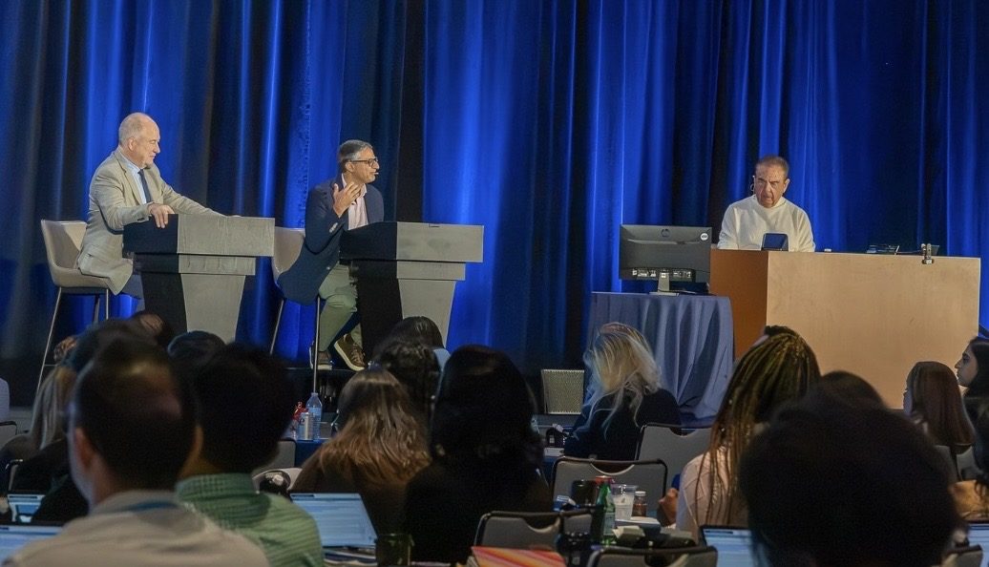

Slide 39
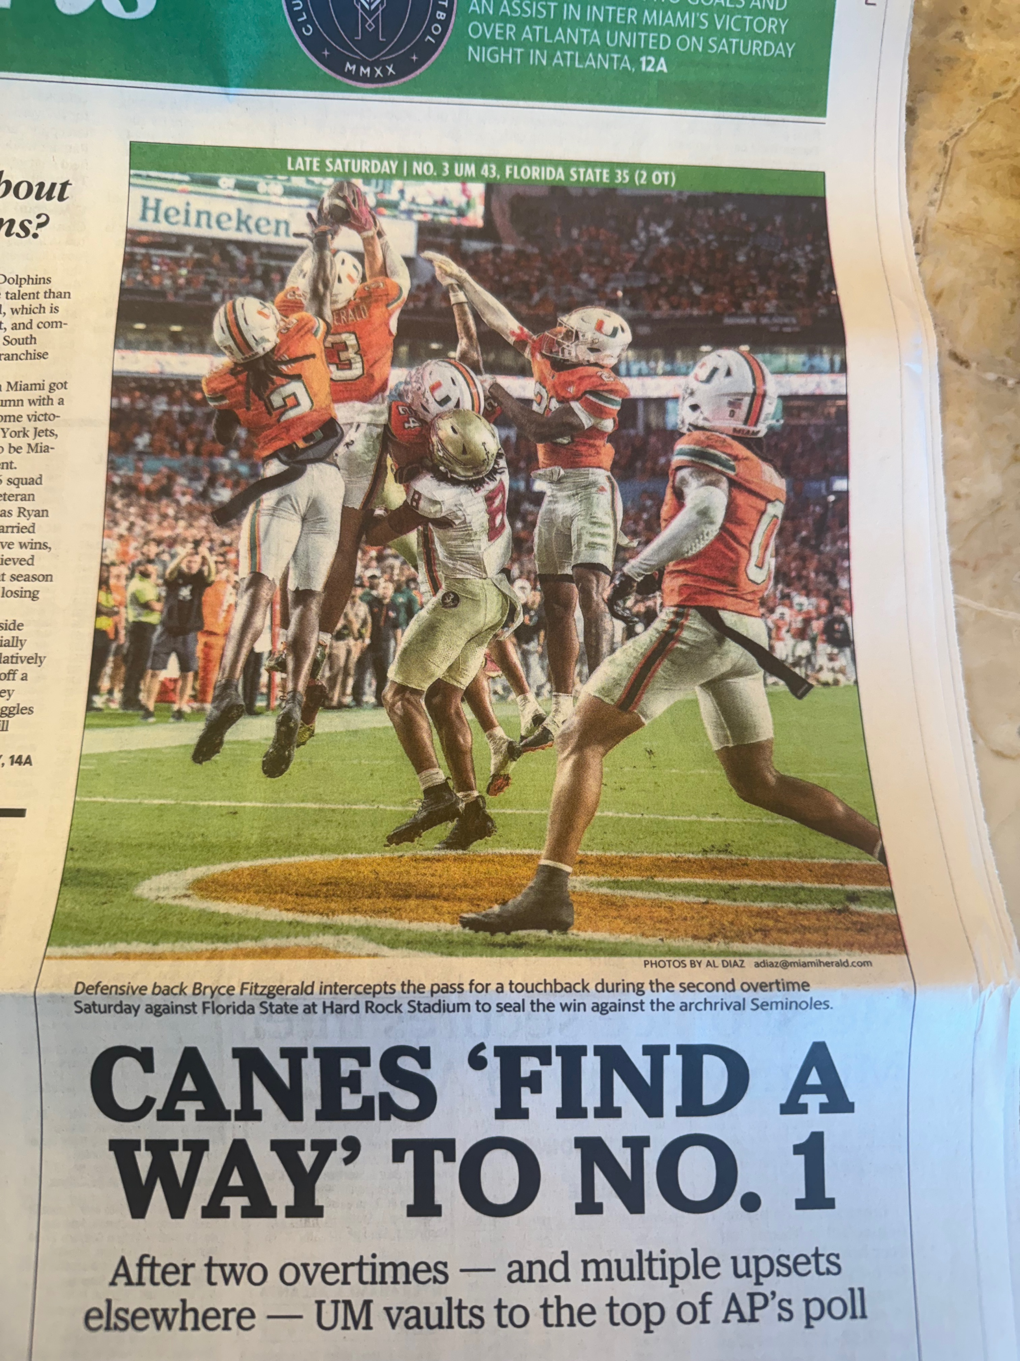

Slide 40







Slide 41
Agenda
Prologue: Saturday Night Fever
Module 1: Baby Boomers’ Guide to Mechanisms of Action
Module 2: Second-Line Treatment
Module 3: Complications Associated with Bispecific Antibodies
Module 4: Case Presentations
Module 5: New Bispecific T-Cell Engagers – Surovatamig
Module 6: Other Novel Agents

Slide 42
Agenda
Module 1: Baby Boomers’ Guide to MOA
Anti-CD20 antibodies
Bispecific antibodies (BsAbs)
CAR T-cell therapy (Signal 1/Signal 2 phenomenon)

Slide 43
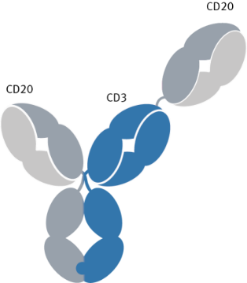












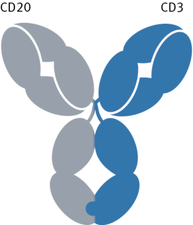
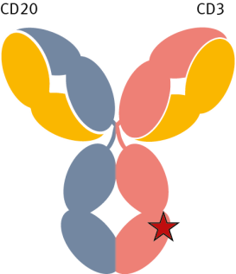
CD20 x CD3 bispecific antibodies
CD3
CD20
CD20
T cell
Tumor cell
CD20
CD3
Activation
CD20
Epcoritamab
DuoBody-CD3×CD20
IgG1
Glofitamab
2+1 CrossMab
IgG1
CD3
FasL
Fas
Release of cytokines
CD20
CD3
CD20
CD3
Release of granzyme and perforin
CD3 ×CD20 bsAbs bring together T cells and CD20+ tumor cells to induce T cell-mediated killing of the tumor cell²
Able to induce effector T cell binding without requiring MHC-mediated antigen presentation²
Mosunetuzumab
Knob-in-hole
IgG1
Odronextamab
VELOCI-Bi
IgG4
1. Engelberts PJ, et al. EBioMedicine. 2020;52:102625. 2. Schuster SJ. Hematological Oncology. 2021;39(S1):113–116. 3. You G, et al. Vaccines. 2021;9:724.
Notes:
You Vaccine 2019: p2-4 Table1
Engelberts EBioMedicine: p8 Fig 3
Schuster Hematological Oncology 2021: p114 Table1
Schuster Hematological Oncology 2021: p115 col1 para3, p116 col1 para3

Slide 44
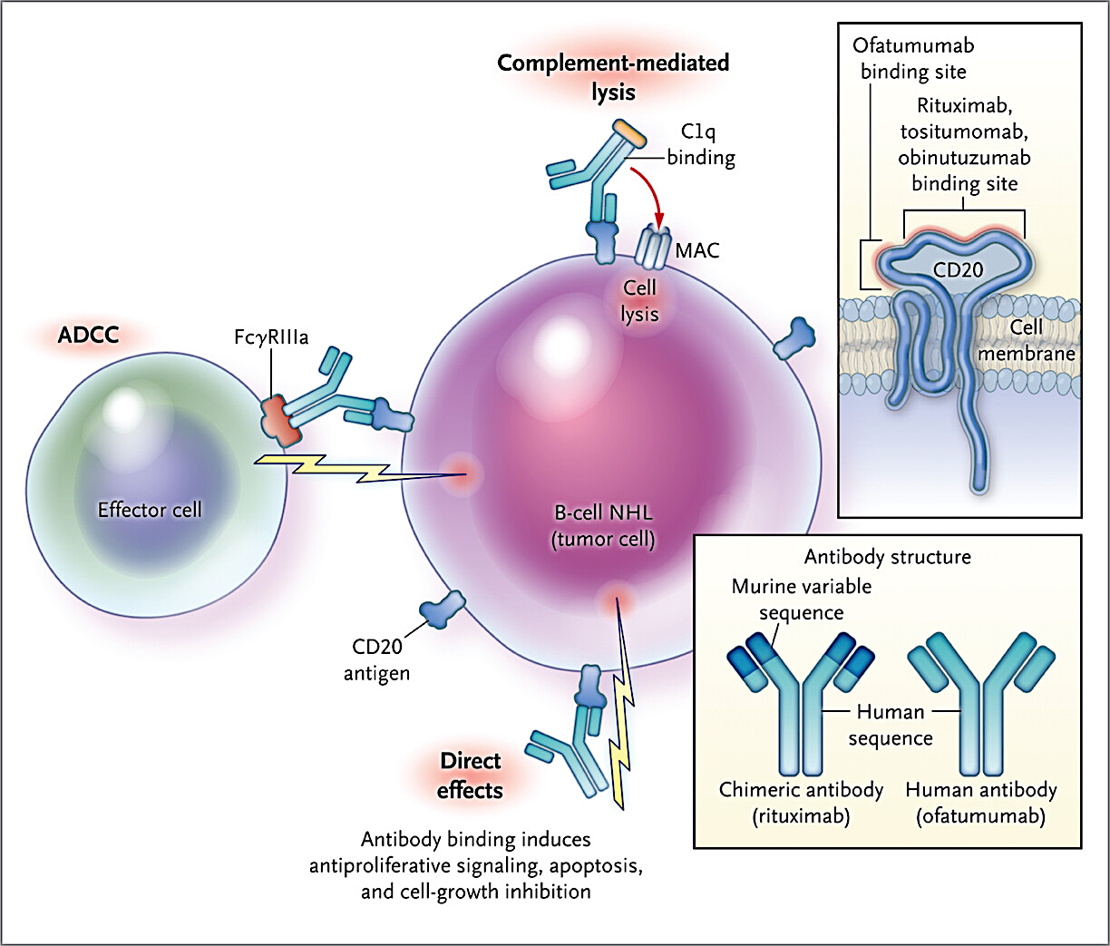
Antitumor Activity of CD20-Directed Antibodies
Maloney DG et al. N Engl J Med 2012;366:2008-16.

Slide 45
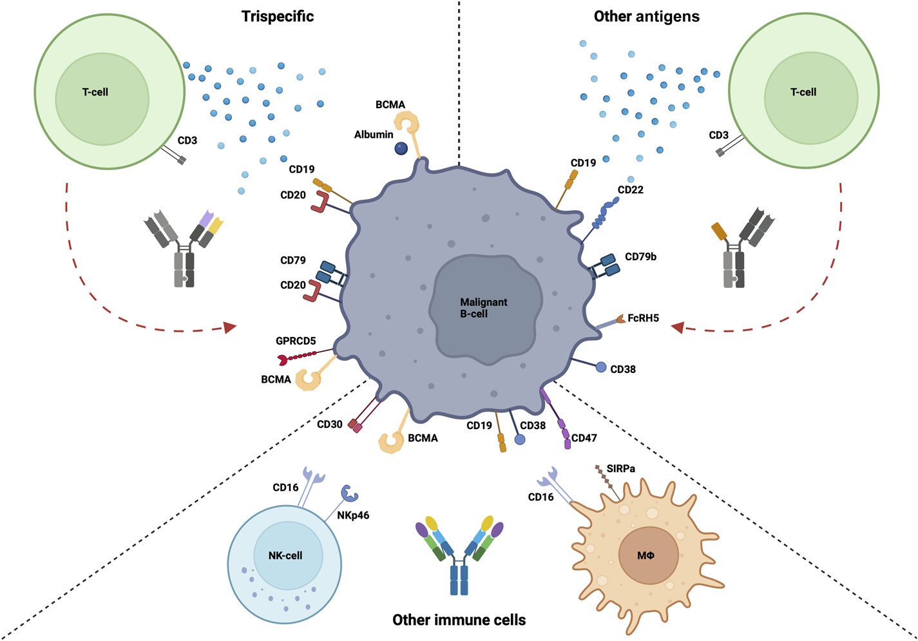
Bispecifics: New agents for new targets
Braun A et al. Am Soc Clin Oncol Educ Book. 2024 Jun;44(3):e433516.

Slide 46
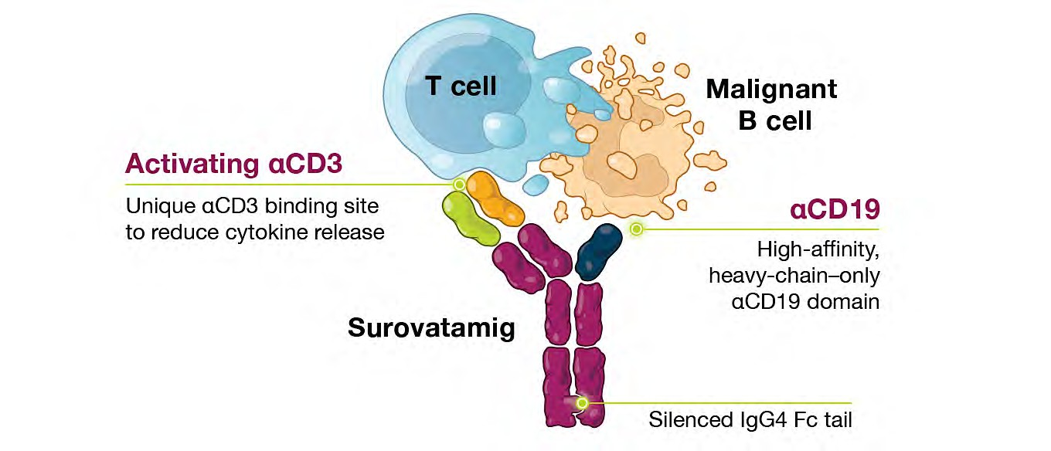
CD19 Bispecific antibodies
Loss of CD20 expression is a common mechanism of resistance, with estimates ranging from 34% to 90%
CD19 is expressed across the spectrum of B-cell lymphomas, and is an established target for T-cell engaging therapy
C_{α}/C_{β} domains replace C_{L}/CH₁ on the CD3 arm

Slide 47

Surovatamig in follicular lymphoma

Slide 48
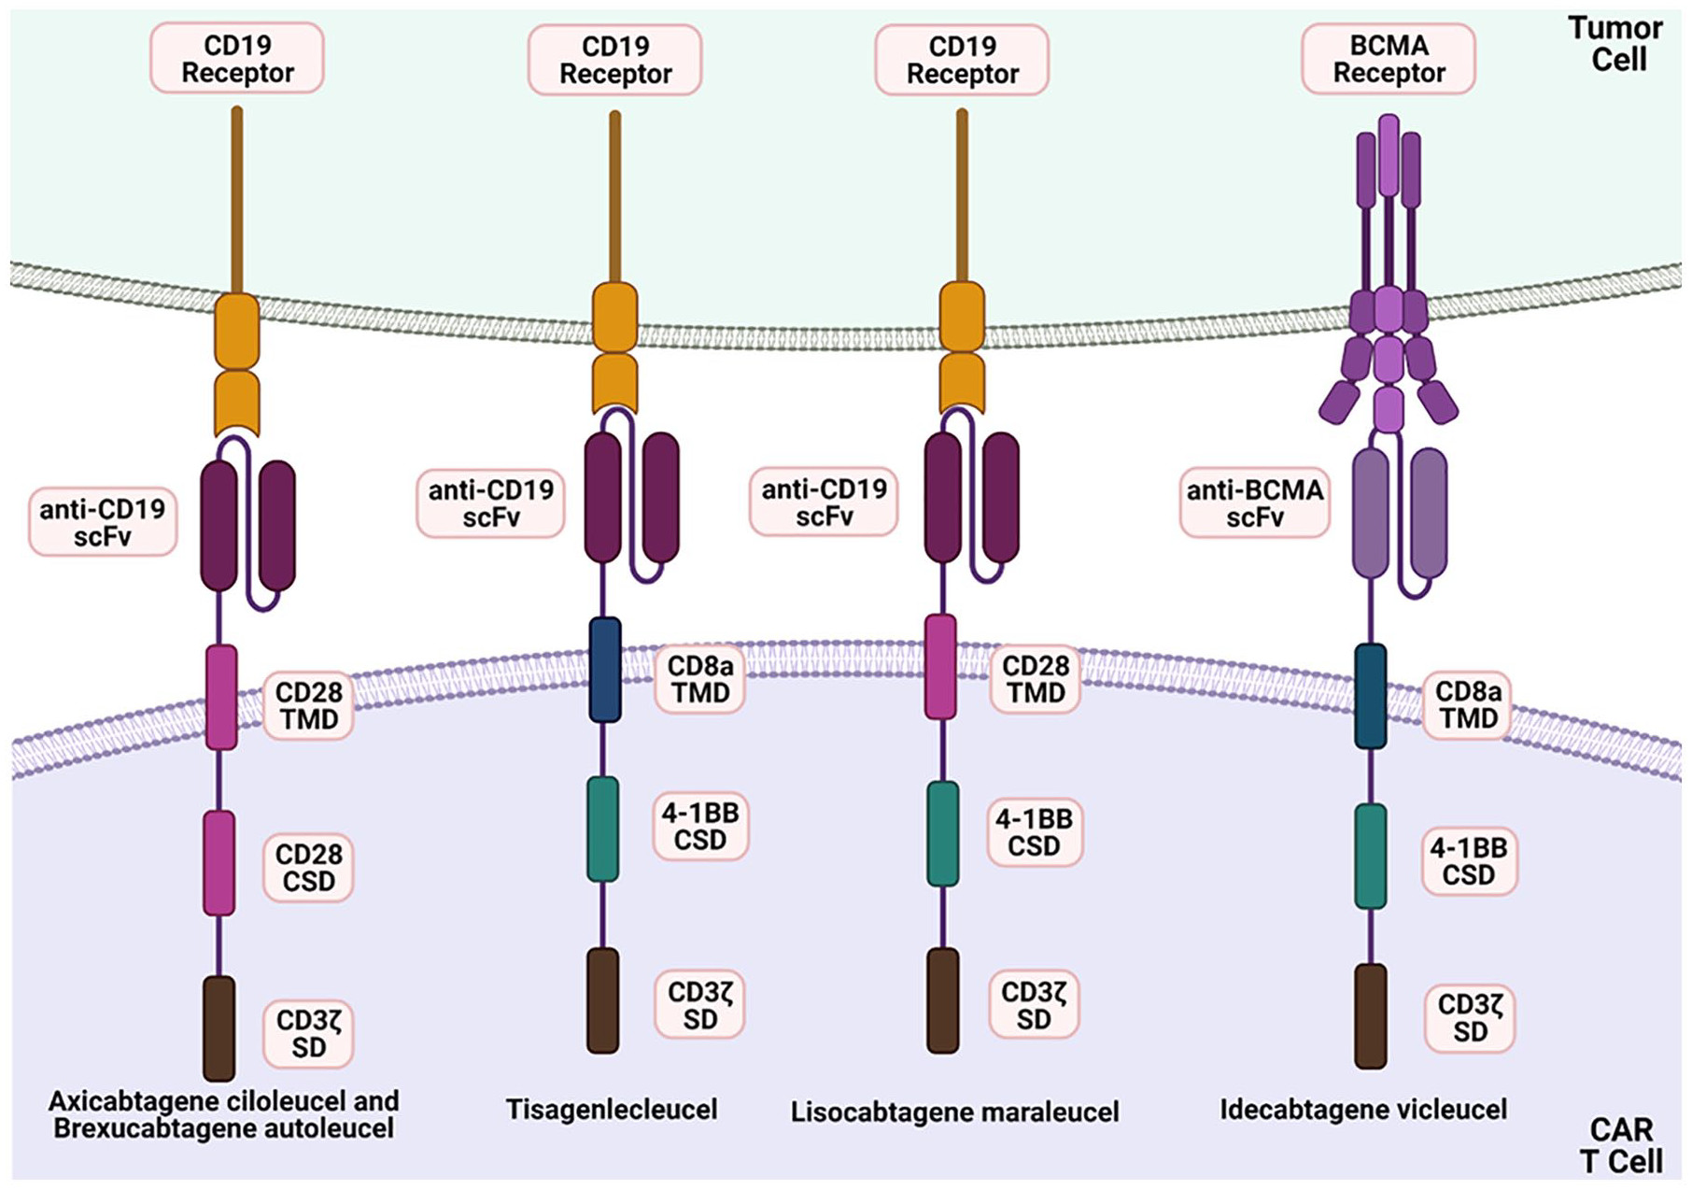
CAR T-Cell Therapies for Follicular Lymphoma
Anderson MK et al. Ann Pharmacother 2022;56(5):609-19.

Slide 49
Agenda
Module 1: Baby Boomers’ Guide to MOA
Anti-CD20 antibodies
BsAbs
CAR T (Signal 1/Signal 2 phenomenon)

Slide 50
Agenda
Prologue: Saturday Night Fever
Module 1: Baby Boomers’ Guide to Mechanisms of Action
Module 2: Second-Line Treatment
Module 3: Complications Associated with Bispecific Antibodies
Module 4: Case Presentations
Module 5: New Bispecific T-Cell Engagers – Surovatamig
Module 6: Other Novel Agents

Slide 51
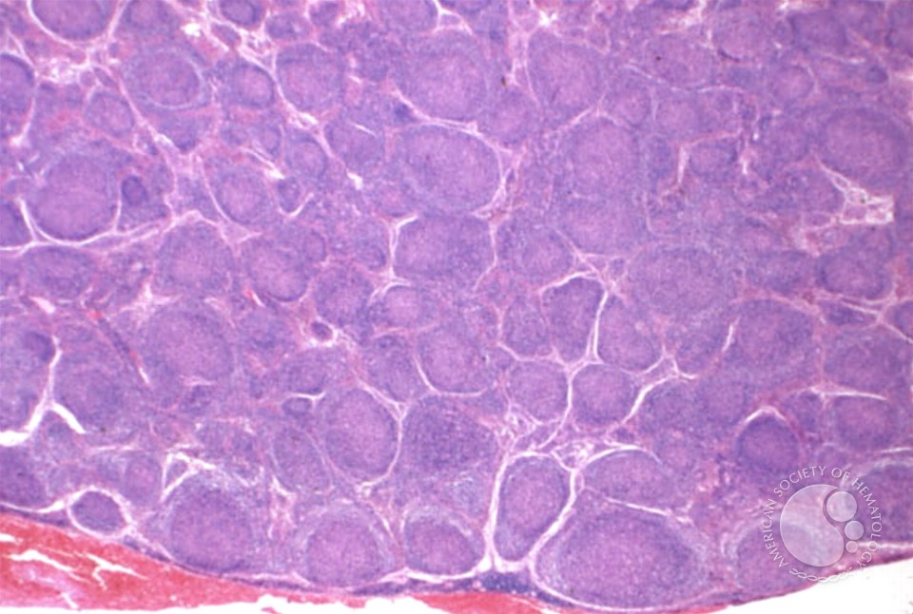
Current use of bispecific antibodies in FL
Professor Chan Cheah
Lymphoma lead and Fellowship program director
Sir Charles Gairdner Hospital
Perth, Western Australia

Slide 52
Key Datasets – Prof Cheah
Qualls D, Salles G. Prospects in the management of patients with follicular lymphoma beyond first-line therapy. Haematologica 2022;107(1):19-34.
Engelberts PJ et al. DuoBody-CD3xCD20 induces potent T-cell-mediated killing of malignant B cells in preclinical models and provides opportunities for subcutaneous dosing. EBioMedicine 2020:52:102625.
Schuster SJ. Bispecific antibodies for the treatment of lymphomas: Promises and challenges. Hematol Oncol 2021;39(Suppl 1):113-6.
You G et al. Bispecific antibodies: A smart arsenal for cancer immunotherapies. Vaccines (Basel) 2021;9(7):724.
Budde E et al. Fixed treatment duration mosunetuzumab continues to demonstrate clinically meaningful outcomes in patients with relapsed/refractory (R/R) follicular lymphoma (FL) after ≥2 prior therapies: 5-year follow-up of a pivotal Phase II study. ASH 2025;Abstract 5352.
Linton KM et al. Epcoritamab monotherapy in patients with relapsed or refractory follicular lymphoma (EPCORE NHL-1): A phase 2 cohort of a single-arm, multicentre study. Lancet Haematol 2024;11(8):e593-605.
Falchi L et al. Primary phase 3 results from the epcore FL-1 trial of epcoritamab with rituximab and lenalidomide (R2) versus R2 for relapsed or refractory follicular lymphoma. ASH 2025;Abstract 466.
Crombie JL et al. Consensus recommendations on the management of toxicity associated with CD3×CD20 bispecific antibody therapy. Blood 2024;143:1565-75.
Reynolds GK et al. Infections in patients with lymphoma treated with bispecific antibodies: A systematic review and meta-analysis. Blood Adv 2024;8:3555-9.

Slide 53
Agenda
Module 2: Second-Line Treatment
Indications to treat relapsed FL: PFS vs TTNT
Mosunetuzumab monotherapy at 5 years: PFS 36%, TTNT 64 months, OS 78%
EPCORE FL-1 – Epcoritamab with R²: PFS HR 0.21, OS HR 0.38
CELESTIMO – Mosunetuzumab/lenalidomide (press release)
Second line: EPCORE FL-1, CELESTIMO, inMIND
Sequencing of BsAbs and CAR T for FL vs DLBCL
TTNT = time to next treatment; R² = lenalidomide/rituximab

Slide 54
Phase II Trial Evaluating Mosunetuzumab in Patients with Relapsed/Refractory FL: Study design
Pivotal, single-arm, multicenter, Phase II expansion in patients with R/R FL and ≥2 prior therapies
Key inclusion criteria
Data analysis
FL Grade 1–3a
ECOG PS 0–1
≥2 prior therapies including an anti-CD20
antibody and an alkylator
Study met its primary endpoint: 60% CR rate versus 14% historic control (p<0.0001)^{1,2}
Updated efficacy and safety analysis with median 37.4 months of follow-up
Mosunetuzumab administration
IV mosunetuzumab administered in 21-day cycles
with step-up dosing in C1
Fixed-duration treatment: Eight cycles if CR after C8;
17 cycles if PR/SD after C8
Retreatment with mosunetuzumab permitted at relapse
for patients who achieved CR
No mandatory hospitalization
D15: 60mg
D1: 60mg
D1: 30mg
D1: 30mg
D8: 2mg
D1: 1mg
C1
C2
C3
C8/17
D, day; ECOG PS, Eastern Cooperative Oncology Group performance status;
IV, intravenous; PR, partial response; SD, stable disease.
Budde E et al ASH 2025 P5352

Slide 55
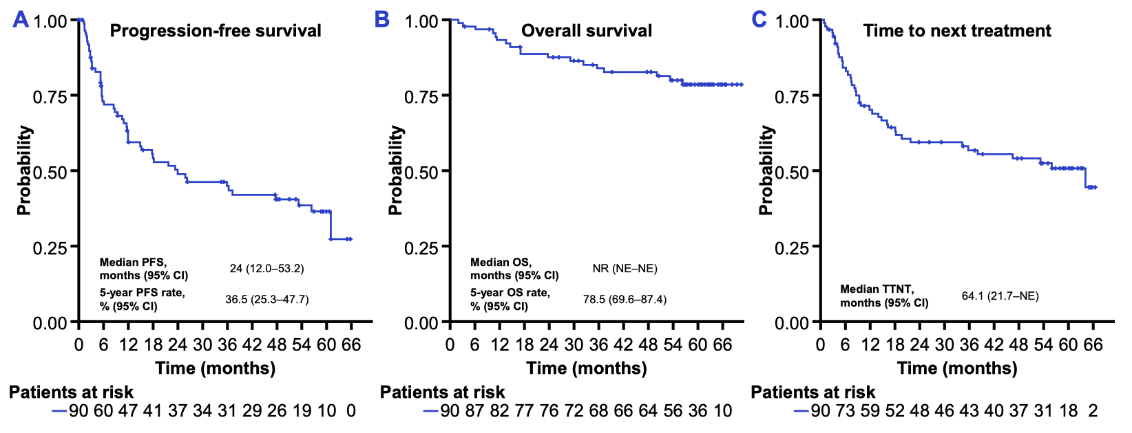
Mosunetuzumab: 5-year FU data
Budde E et al ASH 2025 P5352

Slide 56
Epcoritamab+R² in R/R FL
EPCORE FL-1: Phase 3, Global, Randomized, Open-Label Study
Fixed-Duration: 12 Cycles (28-Day Cycles)
Epcoritamab (48 mg) plus R²
Epcoritamab (3-SUD cycle 1: QW;^{a,b} cycles 2–3, QW; cycles 4–12, Q4W)
Rituximab (375 mg/m²), 5 cycles (cycle 1, QW; cycles 2–5, Q4W)
Lenalidomide (20 mg), 12 cycles (cycle 1–12, QD, D1-21)
Key eligibility criteria
Histologically confirmed CD20+ FL
Grade 1-3a, Stage II-IV
≥ 1 prior treatment including anti-CD20 mAb plus an alkylating agent
Met ≥ 1 GELF criterion
Randomization 1:1
R²
Rituximab (375 mg/m²), 5 cycles (cycle 1, QW; cycles 2–5, Q4W)
Lenalidomide (20 mg), 12 cycles (cycle 1–12, QD, D1-21)
Stratification factors
Disease status:
  2L: > or ≤ 2 years since last therapy
  3L+: > or < 6 months since last therapy
Region: US/EU vs Rest of World
Dual primary endpoints: ORR per IRC and PFS per IRC
Key secondary endpoints: CR rate per IRC, OS, and MRD^{c}
Additional secondary endpoints: DOR, DOCR, TTNLT, safety, and PRO assessments
Data cutoff: May 24, 2025; median follow-up: 14.8 months^{d}
Enrollment period: October 2022 - January 2025
ªTwo step-up dosing (SUD) regimens during cycle 1 to mitigate the risk of cytokine release syndrome: either a 2-SUD (0.16 mg on cycle 1 day 1, 0.8 mg on cycle 1 day 8), or 3-SUD (0.16 mg on cycle 1 day 1, 0.8 mg on cycle 1 day 8, 3 mg on cycle 1 day 15) regimen, followed by full dose 48 mg. The 3-SUD regimen was implemented after reduced CRS severity and incidence had been observed in the EPCORE NHL-1 FL trial (NCT03625037).¹ ^{b}The 24 mg epcoritamab plus R² arm was closed to enrollment based on the superior efficacy for the 48 mg dose from EPCORE NHL-2.² Only the data for the optimal dose explored (48 mg) are presented here. ^{c}Minimal residual disease data are forthcoming in a future analysis. ^{d}The data presented here are from the second planned interim analysis (May 24, 2025) after 78% Information Fraction for PFS had occurred.
1. Vose J, et al. J Clin Oncol. 2024;42(16_suppl):7015–7015. 2. Falchi L, et al. Blood. 2024;144(Supplement 1):342–342.
Falchi et al., ASH 2025; #466

Slide 57
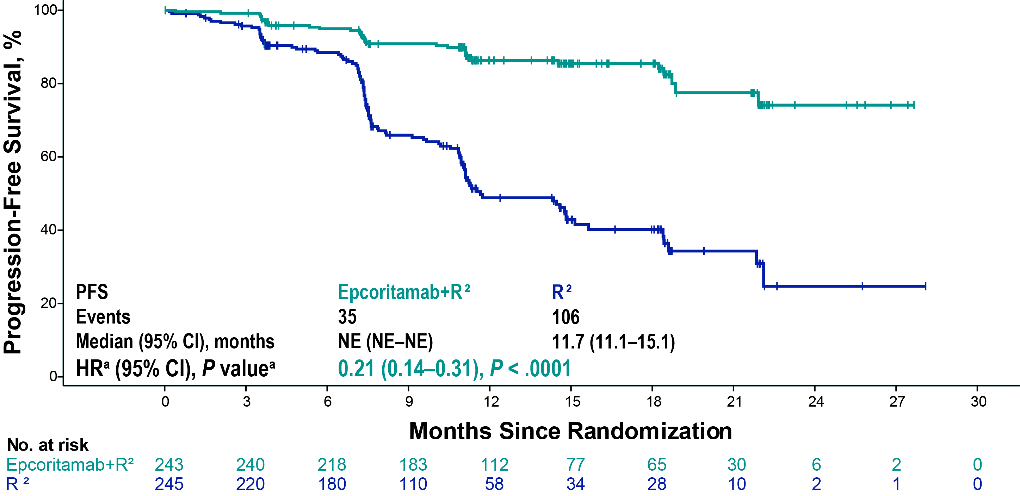
Epcoritamab+R² in R/R FL
EPCORE FL-1: PFS
Concordance rate was 94% for PFS between IRC and investigator assessment
The estimated 16-month PFS was 85.5% (95% CI: 79.7, 89.7) for epcoritamab+R² and 40.2% (95% CI: 31.8, 48.4) for R²
Median follow-up for PFS: epcoritamab+R² (14.4m), R² (11.5m). The first planned interim analysis (January 10, 2025) achieved statistical significance on PFS, HR 0.21 (95% CI 0.13, 0.33) P < 0.0001, with a 1-sided significance level of 0.0023.
ªNominal P value is based on stratified log-rank test. Hazard ratio is estimated using stratified Cox proportional hazards model. This analysis was performed on the 78% information fraction.
Falchi et al., ASH 2025; #466

Slide 58
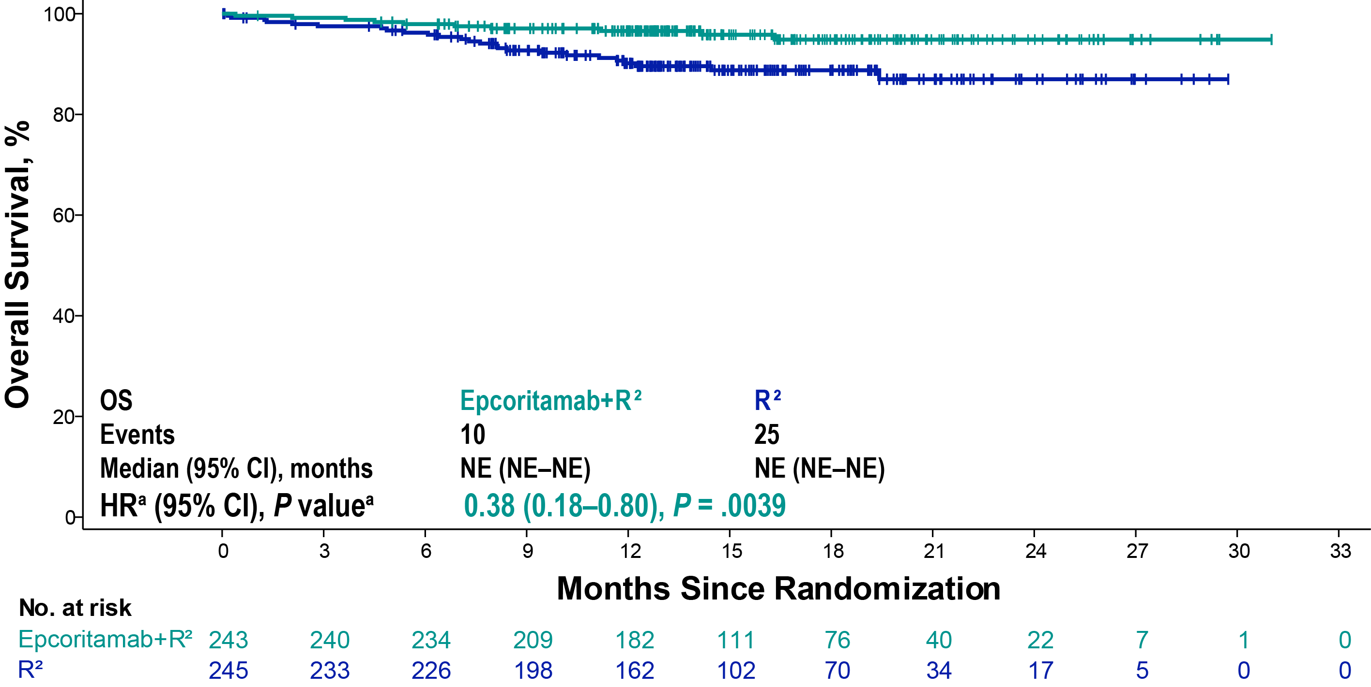
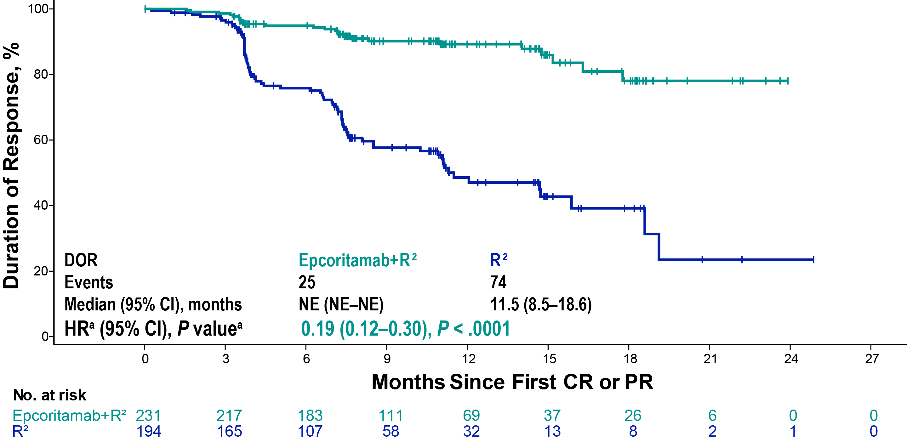
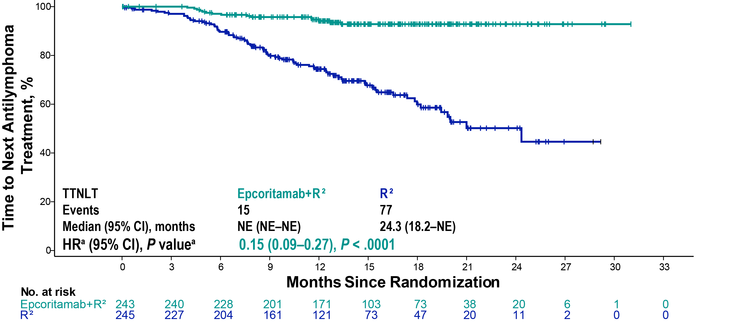
Epcoritamab+R² in R/R FL
EPCORE FL-1: Overall Survival
The 16-month estimate for OS was 95.8% with epcoritamab+R² and 88.8% with R²
Median follow-up for OS: epcoritamab+R² (14.8m), R² (14.6m). The OS data is based on the 24% (35/146 events) information fraction and has not yet reached statistical significance; additional analyses are forthcoming.
ªP value is based on stratified log-rank test with 1-sided significance level of 0.000005. Hazard ratio is estimated using stratified Cox proportional hazards model.
Falchi et al., ASH 2025; #466

Slide 59
Epcoritamab+R² in R/R FL
EPCORE FL-1 Manageable AEs With No New Safety Signals
 | Epcoritamab+R² (N = 243) |  | R² (N = 238)
Adverse Event, n (%) | Any Grade | Grade ≥ 3 | Any Grade | Grade ≥ 3
Any adverse event | 242 (100) | 219 (90) | 235 (99) | 161 (68)
Serious adverse event | 135 (56) | - | 69 (29) | -
Adverse event leading to treatment discontinuation | 46 (19) | - | 29 (12) | -
Epcoritamab | 21 (9) | - | - | -
Rituximab | 7 (3) | - | 12 (5) | -
Lenalidomide | 45 (19) | - | 29 (12) | -
Adverse event of clinical interest > 20%^{a,b}
Infections^{c} | 188 (77) | 81 (33) | 125 (53) | 37 (16)
Neutropenia | 180 (74) | 167 (69) | 123 (52) | 100 (42)
Cytokine release syndrome | 85 (35) | - | 1 (< 1) | -
Anemia | 68 (28) | 19 (8) | 41 (17) | 11 (5)
Thrombocytopenia | 67 (28) | 23 (9) | 44 (18) | 15 (6)
Pyrexia | 58 (24) | 1 (< 1) | 33 (14) | 3 (1)
Rash | 58 (24) | 19 (8) | 53 (22) | 9 (4)
COVID-19 | 54 (22) | 7 (3) | 32 (13) | 4 (2)
Neutropenia was manageable and few patients discontinued any study drug (epcoritamab+R², 3%; R², 2%)
  Incidence of febrile neutropenia: epcoritamab+R², 6%; R², 3%
Infections were manageable and few patients discontinued any study drug (epcoritamab+R², 6%; R², 1%)
Fatal adverse events were rare (epcoritamab+R², 2%; R², 4%)
Despite higher rates of AEs in the epcoritamab+R² arm, most patients completed the prescribed regimen (median relative dose intensity ≥ 90% for epcoritamab+R²)
ªNeutropenia, anemia, pyrexia, rash and COVID-19 are grouped terms comprising multiple clinically related Preferred Terms. ^{b}This includes the AESI of CRS. ^{c}Events were in the MedDRA system organ class “Infections and Infestations.” No grade 5 infections were reported.
Falchi et al., ASH 2025; #466

Slide 60
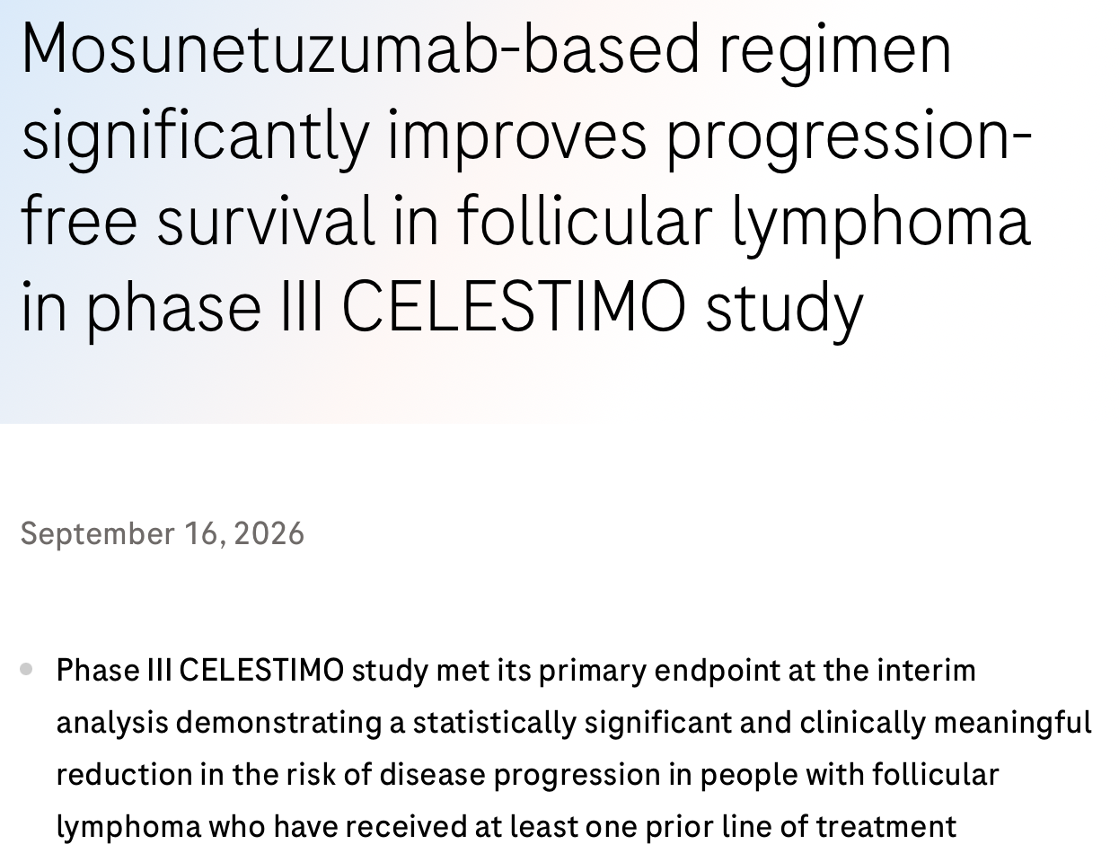
CELESTIMO phase III study design
RANDOMIZE
mosunetuzumab + lenalidomide 12 cycles
FL ≥1 prior line of therapy
stratified by
POD24
no prior lines
CD20 refractoriness
primary endpoint PFS
secondary endpoints ORR, OS, DOR, safety
rituximab + lenalidomide 12 cycles
positive for primary endpoint
https://www.roche.com/media/releases/med-cor-2026-09-17

Slide 61
Agenda
Module 2: Second-Line Treatment
Indications to treat relapsed FL: PFS vs TTNT
Mosunetuzumab monotherapy at 5 years: PFS 36%, TTNT 64 months, OS 78%
EPCORE FL-1 – Epcoritamab with R²: PFS HR 0.21, OS HR 0.38
CELESTIMO – Mosunetuzumab/lenalidomide (press release)
Second line: EPCORE FL-1, CELESTIMO, inMIND
Sequencing of BsAbs and CAR T for FL vs DLBCL
TTNT = time to next treatment; R² = lenalidomide/rituximab

Slide 62
Agenda
Prologue: Saturday Night Fever
Module 1: Baby Boomers’ Guide to Mechanisms of Action
Module 2: Second-Line Treatment
Module 3: Complications Associated with Bispecific Antibodies
Module 4: Case Presentations
Module 5: New Bispecific T-Cell Engagers – Surovatamig
Module 6: Other Novel Agents

Slide 63
Agenda
Module 3: Complications Associated with Bispecific Antibodies
Cytokine release syndrome (CRS): Cycle 1, median duration 2 to 3 days
ICANS: Dysgraphia, altered conscious state; ICE score
Infection: Hypogammaglobulinemia, lymphopenia
Vaccination; antimicrobial prophylaxis; hepatitis B reactivation

Slide 64
CRS summary
Agent / regimen | Trial | Setting | n | any grade CRS | Grade 1 | Grade 2 | Grade ≥3
Mosunetuzumab IV | GO29781, pivotal phase II^{1,2} | ≥3L | 90 | 44.4% | 25.6% | 16.7% | 2.2%: G3 1.1%; G4 1.1%
Mosunetuzumab SC | GO29781, pivotal phase II SC cohort² | ≥3L | 94 | 29.8% | 20.2% | 7.4% | 2.1%, all G3
Epcoritamab 2SUD | EPCORE NHL-1, phase II pivotal cohort³ | ≥3L | 128 | 66.4% | 39.8% | 25.0% | 1.6%, all G3
Epcoritamab 3SUD | EPCORE NHL-1, phase II optimisation cohort³ | ≥3L | 86 | 48.8% | 39.5% | 9.3% | 0%
Epcoritamab + R² overall | EPCORE FL-1, phase III⁴ | ≥2L | 243 | 35% | 28% | 7% | 0%
Epcoritamab + R² 3SUD | EPCORE FL-1, phase III⁴ | ≥2L | 133 | 26% | 21% | 5% | 0%
Mosunetuzumab IV + lenalidomide | CELESTIMO, phase III non-randomised US extension, arm C⁵ | ≥2L | 54 | 27.8% | 22.2% | 3.7% | 1.9%, all G3
Budde LE, et al. Lancet Oncol. 2022;23:1055–1065.
Bartlett NL, et al. Am J Hematol. 2026;101:986–997.
Linton KM, et al. Lancet Haematol. 2024;11:e593–e605.
Falchi L, et al. Lancet. 2026;407:161–173.
Sano D, et al. Blood. 2025;146(suppl 1):1800 (ASH abstract)

Slide 65
CRS timing and tocilizumab use
Monotherapy cohort | CRS timing | Median duration | Tocilizumab use (%)
Mosunetuzumab IV — GO29781¹˒² | Predominantly cycle 1 | 3 days | 7.8%
Mosunetuzumab SC — GO29781² | All events in cycle 1 | 2 days | 8.5%
Epcoritamab, 2SUD EPCORE NHL-1³ | Most commonly after first full dose; median onset 15.3 hours after that dose | 2 days | 24.2%
Epcoritamab, optimised 3SUD EPCORE NHL-1³ | Most commonly after first full dose; median onset 60.7 hours after that dose | 2 days | 11.6%
Budde LE, et al. Lancet Oncol. 2022;23:1055–1065.
Bartlett NL, et al. Am J Hematol. 2026;101:986–997.
Linton KM, et al. Lancet Haematol. 2024;11:e593–e605.

Slide 66
ICANS summary in FL bispecific trials
Agent / regimen | Trial / cohort | N | Any-grade ICANS | Severity | Clinical details
Mosunetuzumab IV | GO29781, pivotal phase II¹ | 90 | 4.4% (4/90) | All G1–2; no G≥3 | Investigator-assessed neurological events consistent with ICANS: confusion, impaired attention and cognitive disorder; all resolved
Mosunetuzumab SC | GO29781, phase II SC cohort² | 94 | 3.1%, as reported in US label | All G1; no G≥3 | Includes ICANS or suspected ICANS
Epcoritamab SC — 2SUD | EPCORE NHL-1, phase II pivotal cohort³ | 128 | 6.3% (8/128) | G1: 3.9%; G2: 2.3%; no G≥3 | Median onset 3.5 days after most recent dose; median resolution 2 days; all resolved; no discontinuations
Epcoritamab SC — 3SUD | EPCORE NHL-1, phase II optimisation cohort³ | 86 | 0% | None | No ICANS reported
Epcoritamab + R² — both schedules | EPCORE FL-1, phase III overall population⁴ | 243 | 0.4% (1/243) | G1; no G≥2 | Single event resolved
Epcoritamab + R² — 3SUD | EPCORE FL-1, phase III subgroup⁴ | 133 | 0.8% (1/133) | G1; no G≥2 | Same event as the overall population
Mosunetuzumab IV + lenalidomide | CELESTIMO, non-randomised US extension, arm C⁵ | 54 | Not reported | Not reported | ICANS incidence not specified in the published abstract; should not be recorded as 0%
Budde LE, et al. Lancet Oncol. 2022;23:1055–1065.
Bartlett NL, et al. Am J Hematol. 2026;101:986–997.
Linton KM, et al. Lancet Haematol. 2024;11:e593–e605.
Falchi L, et al. Lancet. 2026;407:161–173.
Sano D, et al. Blood. 2025;146(suppl 1):1800 (ASH abstract)

Slide 67
Agenda
Prologue: Saturday Night Fever
Module 1: Baby Boomers’ Guide to Mechanisms of Action
Module 2: Second-Line Treatment
Module 3: Complications Associated with Bispecific Antibodies
Module 4: Case Presentations
Module 5: New Bispecific T-Cell Engagers – Surovatamig
Module 6: Other Novel Agents

Slide 68
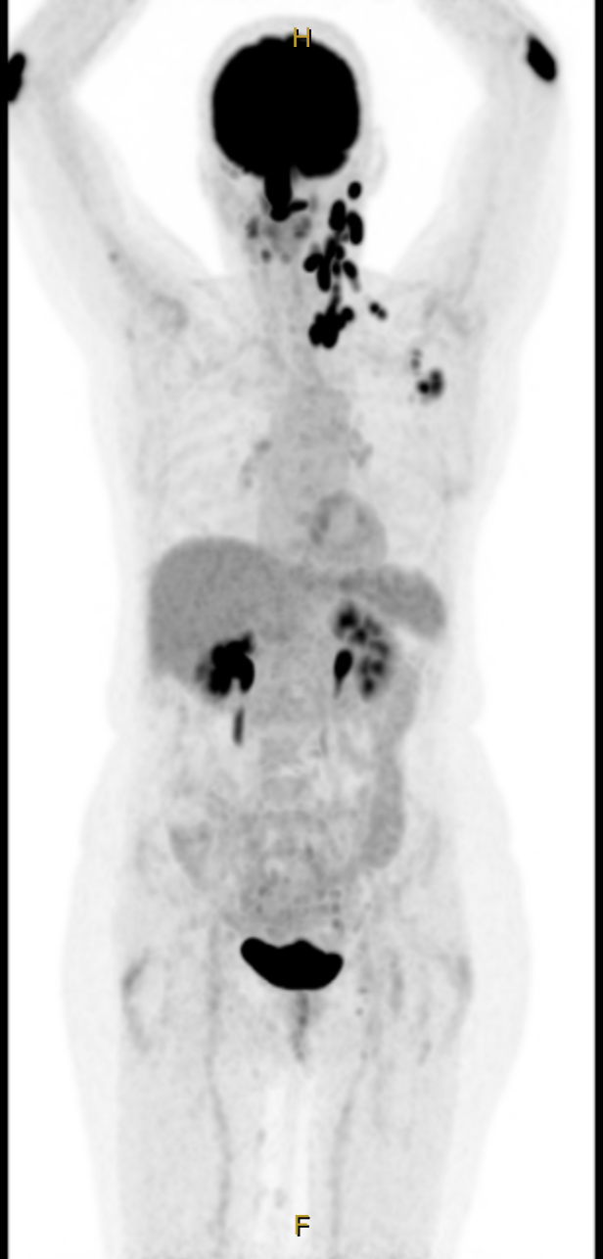
Prof Cheah Case Presentation: 80-year-old woman
PMH
rheumatoid arthritis, T2DM
progression
treated with R-CVP (CMR)
treated with mosunetuzumab
2021
2023
2020
2022
diagnosis, asymptomatic
relapse
treated with R2 (PR)

Slide 69
Clinical Progress
Grade 1 CRS after C1D1
CMR after cycle 3
Develops pneumonia in the setting of hypogammaglobulinemia
Commences IVIg
Completes 8 cycles
Ongoing remission 3 years later

Slide 70
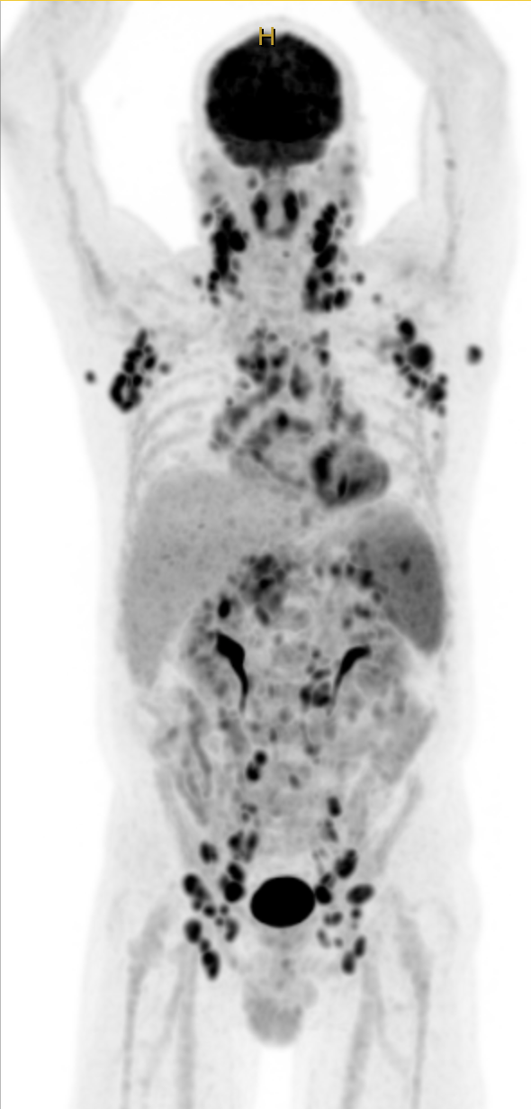
Prof Cheah Case Presentation:
56-year-old man
PMH
hypertension, hypercholesterolemia, smoker, obesity
2014
diagnosis, asymptomatic
W&W
2017
progression with fevers, widespread lymphadenopathy
BR (CMR)
2021
relapse with mediastinal nodes and pleural effusions
offered bispecific study, declines
R-CVP (CMR)
2024 (age 66)
relapse with mediastinal nodes, pleural effusions
treated with epcoritamab + R2

Slide 71
Clinical Progress
Develops grade 2 CRS requiring steroids, tocilizumab after first full dose of epcoritamab
Recurrent G2 injection site reactions requiring topical steroids
Episode of COVID-19 despite vaccination
  prolonged hospitalisation despite early prescription antiviral therapy
  4 days of oxygen requirement
Completes 12 cycles of therapy
Remains in CR 1 year later

Slide 72
Agenda
Prologue: Saturday Night Fever
Module 1: Baby Boomers’ Guide to Mechanisms of Action
Module 2: Second-Line Treatment
Module 3: Complications Associated with Bispecific Antibodies
Module 4: Case Presentations
Module 5: New Bispecific T-Cell Engagers – Surovatamig
Module 6: Other Novel Agents

Slide 73
Emerging Bispecific Antibody Strategies in FL
M-KR-00004345
Matt Matasar, MD
Chief of Blood Disorders, Rutgers Cancer Institute
Professor of Medicine, Rutgers RWJ Medical School

Slide 74
Key Datasets – Dr Matasar
Braun A et al. Bispecific antibody use in patients with lymphoma and multiple myeloma. Am Soc Clin Oncol Educ Book 2024;44(3):e433516.
Hou JZ et al. Three-year follow-up of the Phase 1 first-in-human study investigating surovatamig, a novel CD19xCD3 T-cell engager, in patients with relapsed/refractory (R/R) follicular lymphoma (FL). ASH 2025;Abstract 1005.
Cheah CY et al. Surovatamig (AZD0486) plus rituximab in previously untreated follicular lymphoma (FL): Initial safety data from the phase 3 SOUNDTRACK-F1 trial. EHA 2026;Abstract S228.
Cheah CY et al. SOUNDTRACK-B: A phase 2 single-arm study to evaluate the efficacy and safety of surovatamig (AZD0486) in relapsed or refractory B-cell non-Hodgkin lymphoma. ASH 2025;Abstract 3747.
Song Y et al. Phase 1 study of MK-1045, a novel CD19xCD3 T-cell engager, in participants with relapsed or refractory follicular lymphoma. ASH 2025;Abstract 5372.
Wei J et al. CD22-targeted CD28 bispecific antibody enhances antitumor efficacy of odronextamab in refractory diffuse large B cell lymphoma models. Sci Transl Med 2022;14(670):eabn1082.

Slide 75
Agenda
Module 5: New Bispecific T-Cell Engagers – Surovatamig
Efficacy: Quick MRD-negative durable responses
Toxicity:
  CRS
  ICANS: FL vs large cell lymphoma
  Infections
Case presentation: 57-year-old man
Key ongoing trials
SOUNDTRACK-F1: Surovatamig/rituximab ± surovatamig maintenance vs chemoimmunotherapy + rituximab maintenance
  SOUNDTRACK-B: Surovatamig monotherapy for R/R FL and R/R DLBCL
  Multinational investigator-initiated study Stage I/II FL: Surovatamig vs involved-site radiation therapy (ISRT) ± rituximab

Slide 76
Surovatamig Phase 1 Study Design
Dosing Regimen
Double SUD (n=43)
TD
TD
TD
Target Doses: 2.4–15 mg
15 mg (n=15)
1.0 mg
7.2 mg (n=19)
0.27 mg
2.4 mg (n=9)
C1
D1
C1
D8
C1
D15
C2–24
Q2W (D1, 15)
Surovatamig Treatment
Surovatamig is administered intravenously in fixed-dose escalation, 1SUD, or 2SUD
Treatment is delivered in 28-day cycles up to 2 years
  Cycle 1 doses were inpatient
Patients with CR on 2 consecutive scans may receive surovatamig every 4 weeks after C6
Premedication with dexamethasone included two 10-mg doses prior to cycle 1 surovatamig doses
NCT04594642; data cutoff: May 19, 2025
Hou et al. ASH 2025;Abstract 1005

Slide 77
Patients Were Heavily Pretreated
61 patients received ≥1 dose of surovatamig
Characteristic | N=61ª
Age, median (range), y | 63 (33–86)
ECOG PS 2, n (%) | 2 (3)
Ann Arbor stage III–IV, n (%) | 49 (80)
CD20-negative disease at study entry, n (%) | 10 (16)
Bulky disease,^{b} n (%) | 13 (21)
POD24, n (%) | 22 (36)
Median prior lines of therapy (range) | 3 (2–11)
3–4 lines, n (%) | 27 (44)
≥5 lines, n (%) | 9 (15)
Refractory to last line of therapy,^{c} n (%) | 32 (52)
Prior types of treatment, n (%)
R-CHOP | 37 (61)
Lenalidomide | 26 (43)
CD19-directed CAR T | 7 (11)
CD20 TCE | 5 (8)
Allogeneic or autologous SCT | 3 (5)
20 patients
discontinued treatment:
Disease progression (n=8)
Physician decision (n=4)
AEs (n=3)
Withdrawal by patient (n=2)
Treatment delay (n=1)
Other (n=2)
11 patients completed treatment
and
30 patients remain on treatment
Median study follow-up for TDs ≥2.4 mg:
16 mo (range 1–40)
ªRacial demographics included White (56%), Asian (38%), Black or African American (2%), and not reported (5%); 59% of study participants were male, 41% were female
^{b}Defined as having the longest diameter ≥7 cm at baseline target lesion assessment or having 3 or more lesions that are ≥3 cm each
^{c}Defined as SD/PD as best response from last prior line of therapy or if disease progression occurred within 6 months of the last prior cancer therapy end date
Hou et al. ASH 2025;Abstract 1005

Slide 78
High Response Rates Observed at All Target Doses
ORR:
100%
ORR:
100%
ORR:
90.9%
ORR/CR rate for patients who received ≥2.4 mg was 96%/92%
In the ITT population, ORR/CR rates were 100%/93%, 87%/83% and 100%/100% in the
2.4-mg, 7.2-mg and 15-mg cohorts, respectivelyª
ªITT population includes 1 additional patient who discontinued prior to response assessment due to AE at 7.2 mg TD
Hou et al. ASH 2025;Abstract 1005

Slide 79
High CR Rates Overall and in High-Risk Populations
for TD ≥2.4 mg
Patients, n (%)
CR rate, % (95% CI)
All patients | 52 (100) |  | 92.3 (81.5, 97.9)
CD20 disease status
Positive | 44 (84.6) |  | 93.2 (81.3, 98.6)
Negative | 8 (15.4) |  | 87.5 (47.3, 99.7)
Prior CD19 CAR T
Yes | 6 (11.5) |  | 66.7 (22.3, 95.7)
No | 46 (88.5) |  | 95.7 (85.2, 99.5)
Prior CD20 TCE
Yes | 5 (9.6) |  | 80.0 (28.4, 99.5)
No | 47 (90.4) |  | 93.6 (82.5, 98.7)
Refractory to last line of therapy
Yes | 24 (46.2) |  | 87.5 (67.6, 97.3)
No | 28 (53.8) |  | 96.4 (81.7, 99.9)
POD24
Yes | 18 (34.6) |  | 100 (81.5, 100)
No | 34 (65.4) |  | 88.2 (72.5, 96.7)
Prior R-CHOP
Yes | 32 (61.5) |  | 87.5 (71.0, 96.5)
No | 20 (38.5) |  | 100 (83.2, 100)
Prior lenalidomide
Yes | 21 (40.4) |  | 95.2 (76.2, 99.9)
No | 31 (59.6) |  | 90.3 (74.2, 98.0)
CR rate (%)
Hou et al. ASH 2025;Abstract 1005

Slide 80
Durable Responses Observed, Including in Patients With Prior CD20 TCE and/or CD19 CAR T
1.0
0.8
0.6
Probability of Remaining
Event Free
0.4
12-mo estimate:
91.4% (95% CI: 78.6, 96.7)
0.2
DOR TD ≥2.4 mg (N=50)
0.0
0
3
6
9
12
15
18
21
24
27
30
33
36
39
No. at risk
Months
DOR TD ≥2.4 mg
50
47
44
32
23
17
14
12
10
7
4
3
2
0
All 8 patients with prior CD20 TCE therapy and/or CD19 CAR T who achieved CR with surovatamig remain in CR
All 11 patients who completed surovatamig treatment remain in CR off treatment
Hou et al. ASH 2025;Abstract 1005

Slide 81
MRD Negativity Correlated With Durable Responses
01
✚
■
02
✚
➖
03
✚
■
➖
■
04
➖
05
➖
■
➖
■
2.4 mg
06
✚
✚
✚
07
■
➖
➖
08
✚
■
➖
09
■
➖
✚
➖
■
10
✚
✚
✚
✚
✚
➖
■
✚
✚
⨁
11
●
✚
✚
12
✚
✚
✚
✚
✚
✚
✚
➖
■
13
✚
■
➖
14
➖
■
15
➖
■
16
➖
■
⨁
17
✚
■
✚
✚
✚
✚
✚
✚
✚
18
➖
■
⨁
19
✚
■
➖
20
➖
■
21
✚
■
➖
7.2 mg
22
➖
■
Patientsª
23
➖
■
✚
✚
➖
24
➖
■
25
✚
■
➖
MRD Negative
MRD Positive
CR
SD
PR
Progression
Detected
Not Detected
Ongoing
26
■
✚
➖
27
✚
28
■
➖
29
➖
■
➖
■
30
✚
●
➖
⨁
31
✚
✚
▲
32
➖
■
33
➖
■
34
➖
■
35
➖
■
36
➖
■
37
➖
■
⨁
38
➖
■
15 mg
39
➖
■
40
✚
■
41
➖
➖
■
✚
42
➖
■
➖
43
✚
✚
✚
■
44
➖
■
45
✚
■
➖
46
0
➖
■
4
8
12
16
20
24
Treatment Duration (months)
95% (41/43) of MRD-evaluable patients with CR had undetectable MRD
12-month PFS estimates were 97% for patients with undetectable MRD and 50% for patients with detectable MRD
ªOnly patients with BOR ≥SD
Hou et al. ASH 2025;Abstract 1005

Slide 82
Rapid Clearance of ctDNA in MRD Responders
2
Dose
2.4 mg
7.2 mg
15 mg
0
-2
PVAF Log Fold Change
-4
-6
undetectable
0
4
8
12
16
20
ctDNA assessed by PhasED-Seq
Time on Treatment (months)
Hou et al. ASH 2025;Abstract 1005

Slide 83
Adverse Events in All Patients
Most common AEs (≥20%), n (%) | Any grade | Grade 3 | Grade 4
CRS | 35 (57) | 0 | 0
COVID-19 | 20 (33) | 2 (3) | 0
Headache | 20 (33) | 0 | 0
Nausea | 19 (31) | 0 | 0
Diarrhea | 18 (30) | 0 | 0
Cough | 17 (28) | 1 (2) | 0
Fatigue | 15 (25) | 1 (2) | 0
Neutropenia | 14 (23) | 9 (15) | 3 (5)
Hypogammaglobulinemia | 14 (23) | 0 | 0
Hypertension | 13 (21) | 5 (8) | 0
Infections occurred in 43 (70%) patients (grade 3/4: n=8 [13%]; grade 5: n=2 [3%])
  The most common infections (≥5%) were COVID-19, upper respiratory tract infection, pneumonia, sinusitis, nasopharyngitis, rhinitis, and UTI
Two grade 5 events were reported (COVID-19 and sepsis)
Hou et al. ASH 2025;Abstract 1005

Slide 84
Summary of CRS With 2SUD
n (%) unless stated | n=43
Any grade CRSª | 22 (51)
Grade 1 | 21 (49)
Grade 2 | 1 (2)
Median time to CRS onset,^{b,c} h (range) | 16 (5–42)
Median CRS duration,^{c} h (range) | 21 (1–47)
CRS management
Tocilizumab | 5 (12)
Corticosteroids | 3 (7)
CRS resolution | 22 (100)
Frequency and grade of CRS events
Events, %
ªFor each patient, CRS events are counted once at the maximum grade reported
^{b}From time of infusion to CRS
^{c}Data include doses administered per protocol dose and schedule
Hou et al. ASH 2025;Abstract 1005

Slide 85
Summary of ICANS With 2SUD
n (%) unless stated | n=43
Any grade ICANSª | 2 (5)
Grade 1 | 1 (2)
Grade 2 | 1 (2)
Median time to ICANS onset,^{b,c} h (range) | 34 (20–50)
Median ICANS duration,^{c} h (range) | 21 (9–25)
ICANS management
Dexamethasone | 0
ICANS resolution | 2 (100)
Frequency and grade of ICANS events
Events, %
ªFor each patient, ICANS events are counted once at the maximum grade reported
^{b}From time of infusion to ICANS
^{c}Data include doses administered per protocol dose and schedule
Hou et al. ASH 2025;Abstract 1005

Slide 86
Conclusions
Surovatamig treatment is well tolerated and leads to durable responses in patients with heavily pretreated R/R FL, including those with prior exposure to CD19 CAR T or CD20 TCEs
CR rate of 92% in R/R FL at target doses ≥2.4 mg
95% of MRD-evaluable patients with CR achieved undetectable MRD
All CRS and ICANS events were low grade with 2SUD
Phase 2 and 3 trials of surovatamig in R/R FL and treatment-naive FL are underway (NCT06526793 and NCT06549595, respectively)

Slide 87
Dr Matasar Case Presentation:
57-year-old man
57-year-old man without major medical history, competitive rucker, diagnosed with Gr3BFL in 2022, treated with RCHOPx6, achieving a PR, bx confirmed 3BFL. Treated with 2L lisocel without bridging 10/2022, achieving a CR. Relapsed 11/2023 with low-grade FL, CD19+CD20+. PET imaging revealed diffuse lymphadenopathy without variable/high grade FDG avidity. Labwork with normal CBC and LDH, patient reported fatigue that did not limit activities other than competitive sport.
Presented options including lenalidomide-based treatment, CD20 bispecifics, clinical trial with surovatamig, which he opted for

Slide 88
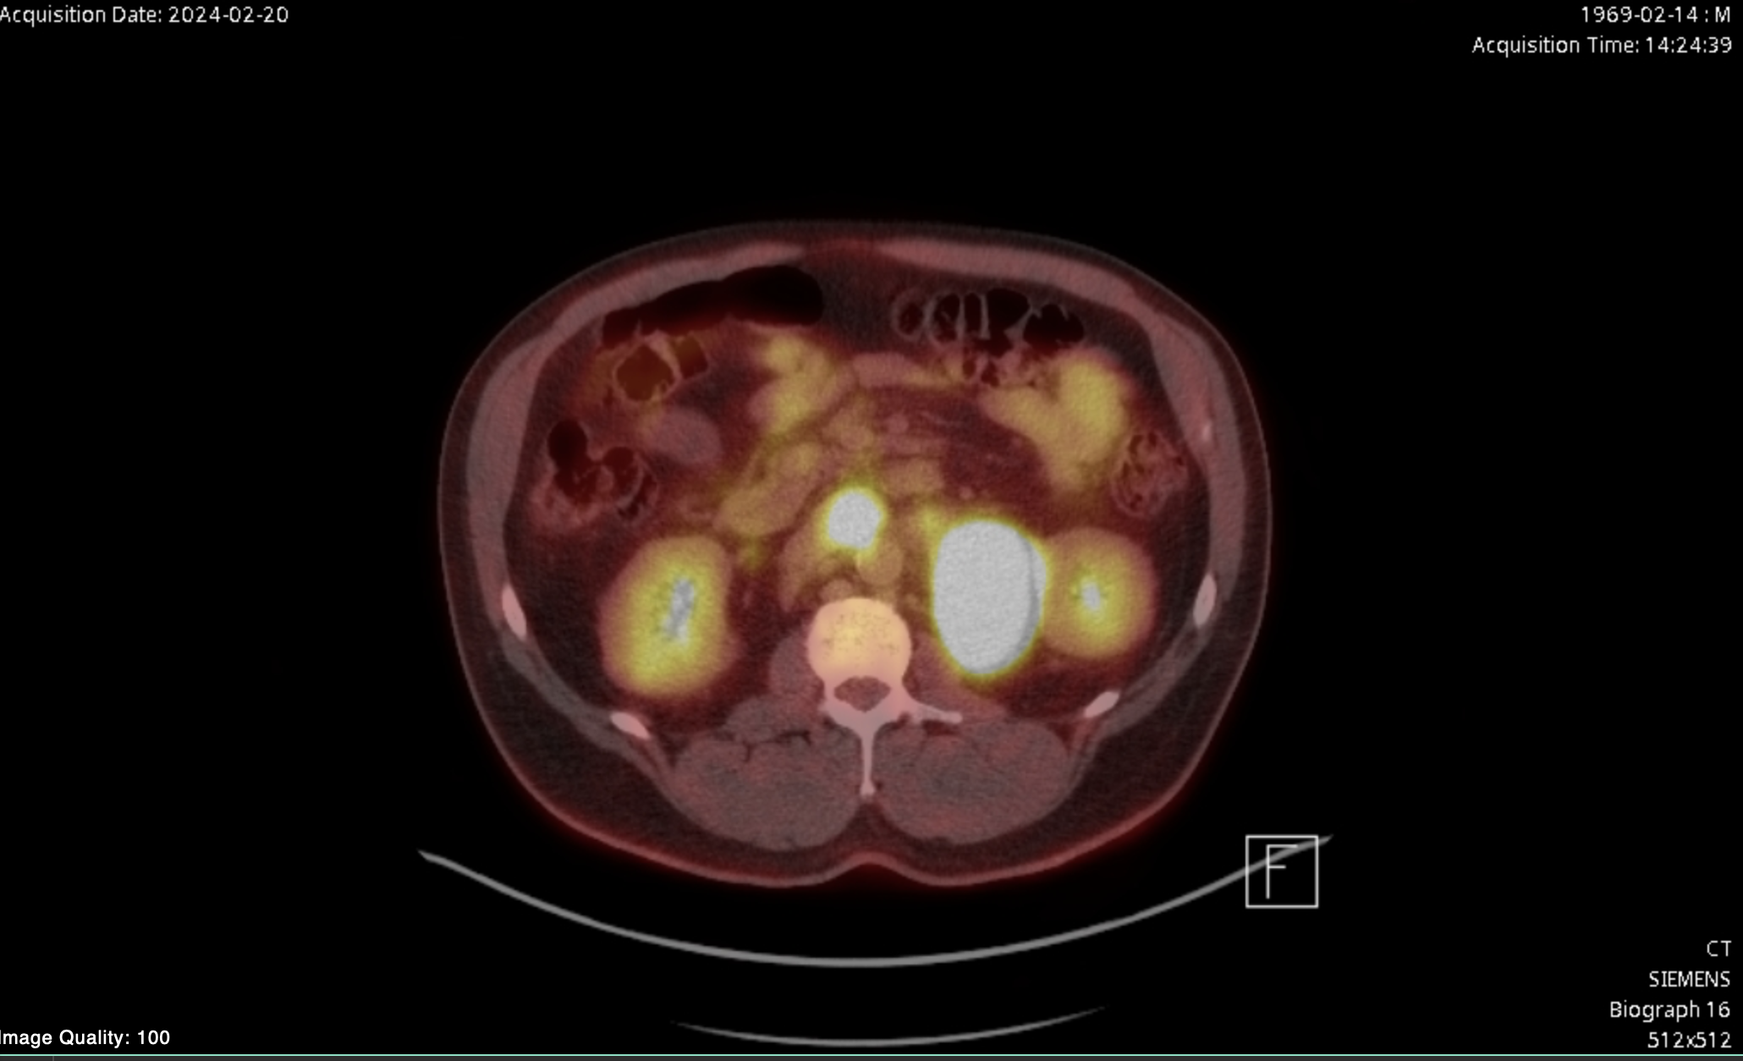
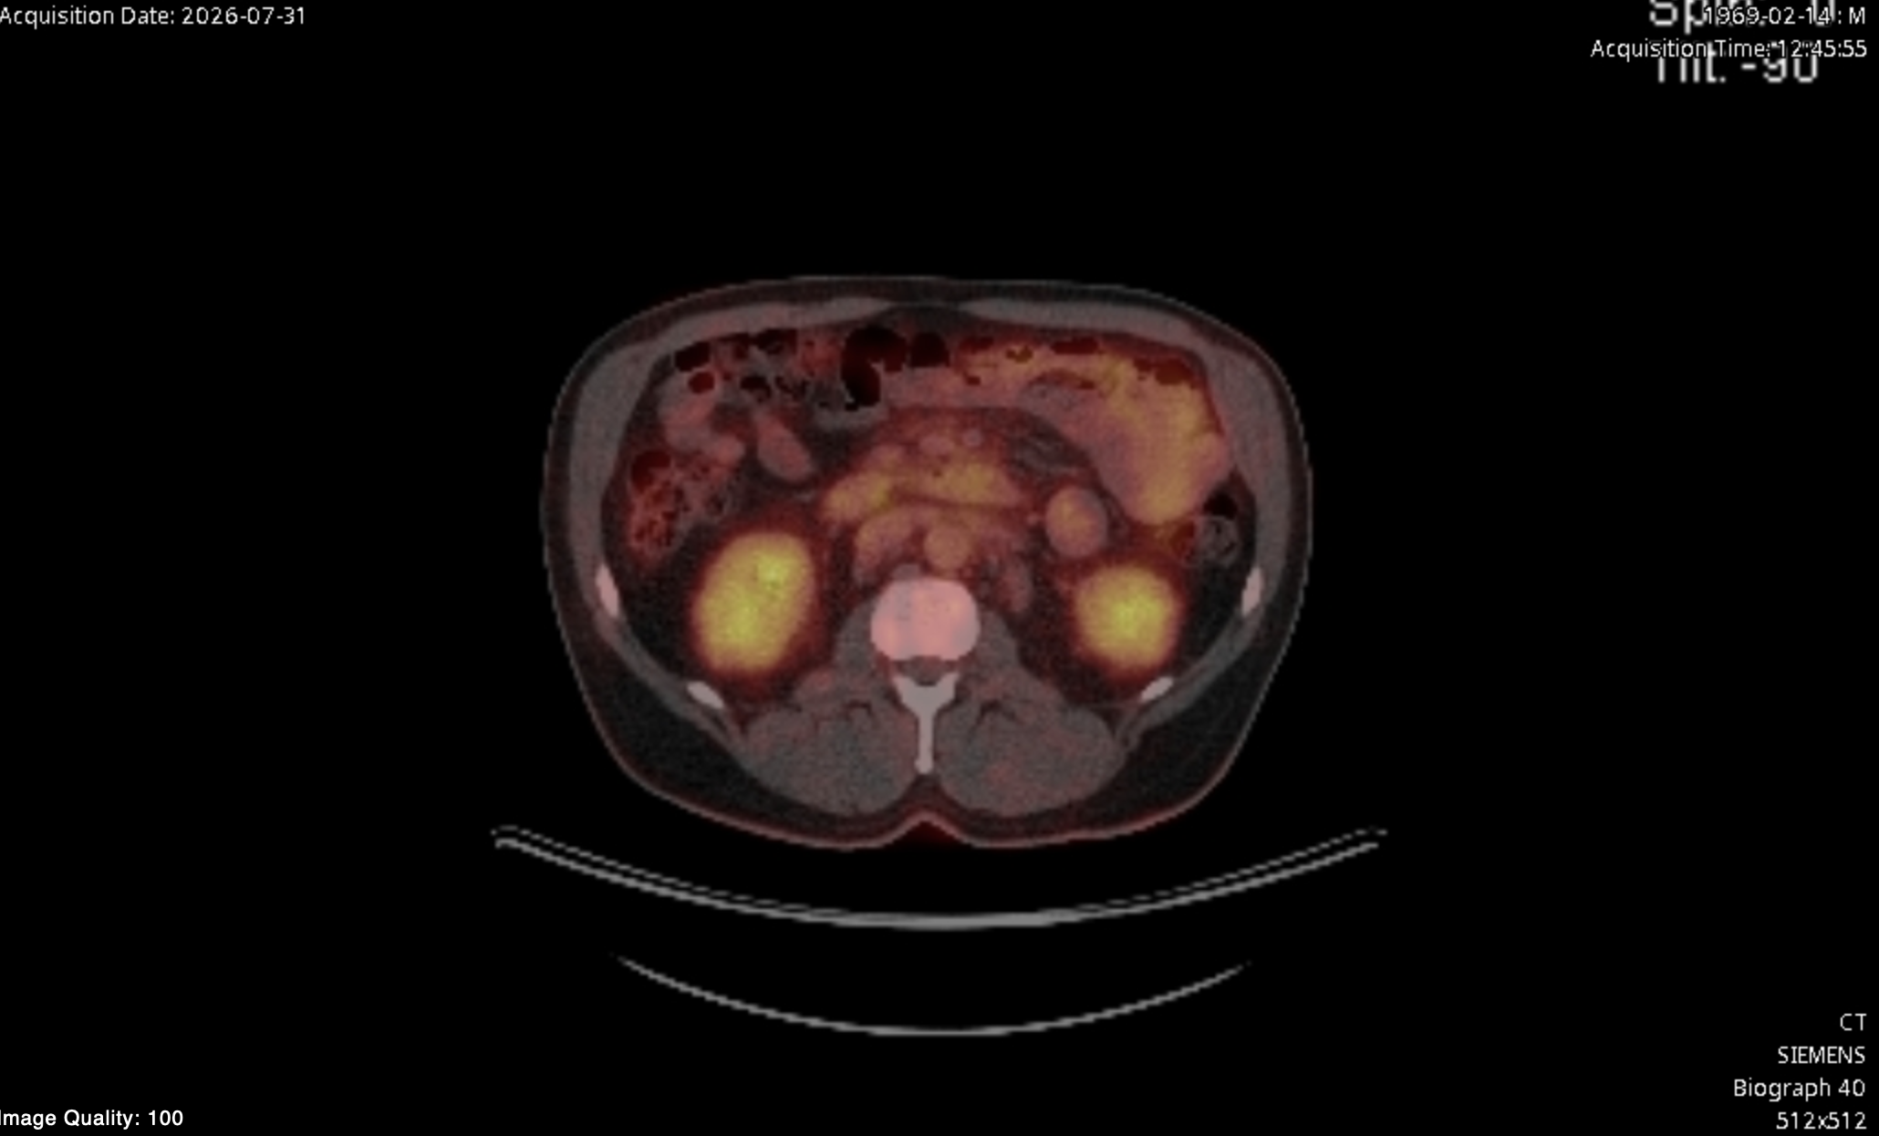
Dr Matasar Case Presentation: 57-year-old man
(continued)
Pt selected clinical trial participation with surovatamig, started February 2024. Tolerated SUD without CRS/ICANS, achieved CR at first restaging. Completed 24 cycles January of 2026, ongoing CR off treatment

Slide 89
Surovatamig in FL – Next steps

Slide 90
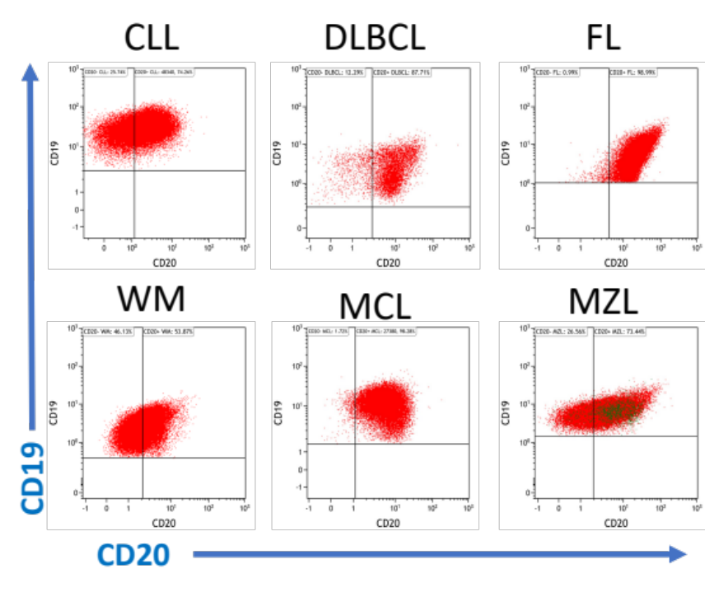
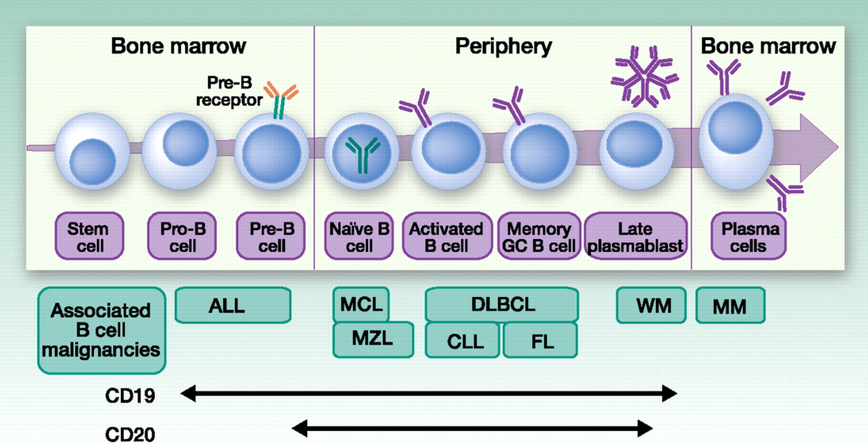
Combination of Surovatamig + Rituximab: Rationale
Dual CD19 + CD20 targeting overcome limitations of CD20
CD19 is a surface receptor present on neoplastic B cells that has a broader expression than CD20 making it an attractive target for
B-cell malignancies.
Effectiveness of targeting CD19
has been validated by CD19 CAR T-
cells therapy
CD20 antigen expression variable due to tumor heterogeneity
CD20 antigen frequently lost
after CD20-targeted therapy
1
2
3
11% (7/62) CD20 LOW
at baseline
r/r DLBCL
Treatment with CD20xCD3
28% (8/29) CD20 LOST
at progression
r/r DLBCL
Dual targeting: has potential to lead to deeper and longer remissions in B-cell malignancies

Slide 91
SOUNDTRACK-F1: Trial Design
DL 2 (N=20)
R + Surovatamig (TD 7.2 mg, Q2W)
x 7 cycles
CR/PR
Maintenance
Surovatamig monotherapy (Q4W)
x 17 cycles
Safety Run In
N=40
1:1
DL 1 (N=20)
R + Surovatamig (TD 2.4 mg, Q2W)
X 7 cycles
CR/PR
Maintenance
Surovatamig monotherapy (Q4W)
x 17 cycles
Patient Population Untreated FL
Target population:
  Treatment naïve FL
  Meet GELF criteria
  [Ph3]: Excluding
    Stage I
    FLIPI 0/1
RP3D
Arm A (N=325)
R + Surovatamig (Q2W)
x 7 cycles
Observation
Phase III
N=975
Arm B (N=325)
R + Surovatamig (Q2W)
x 7 cycles
CR/PR
Maintenance
Surovatamig monotherapy (Q4W)
x 17 cycles
1:1:1
Stratification:
1) FLIPI score (2 vs 3-5)
2) Chemo arm
Arm C (N=325)
Investigator’s choice
RCHOP/ RCVP/ BR
x 6 cycles
Maintenance
R after RCHOP/RCVP/BR (Q8W)
Every 2 months (x 2 years)
CR/PR
  Endpoints:
  Primary:
    Safety Run-in: Safety and tolerability of Surovatamig + R and RP3D determination
    Phase III: Dual primary with PFS & EoI ORR assessed by IRC based on Lugano Response Criteria
  Secondary:
    Safety Run-in: Efficacy (ORR, CRR, CR@EOI, CR30, DoR, PFS, OS), PK/PD/Immunogenicity
    Phase III: Efficacy (OS: Key Secondary), ORR, CRR, ER EoI, CR30, DoR, PFS, TTNT), safety, PK/Immunogenicity, PRO, MRD-ve CR rate
B: Bendamustine; CNS: Central nervous system; CR: complete response; CR30: complete response at 30 months; DL: Dose level; DoR: Duration of Response; EOI: end of induction; FL: Follicular Lymphoma; MRD: Minimal residual diseaseORR: Overall response rate; PB: peripheral blood; OS: Overall survival; PFS: progression free survival; PR; partial response; PRO: Patient reported outcome; QxW: every x weeks; R: rituximab; RP3D: recommended Ph3 dose; SOC= standard of care; TD= target dose; TTNT: Time to next treatment

Slide 92
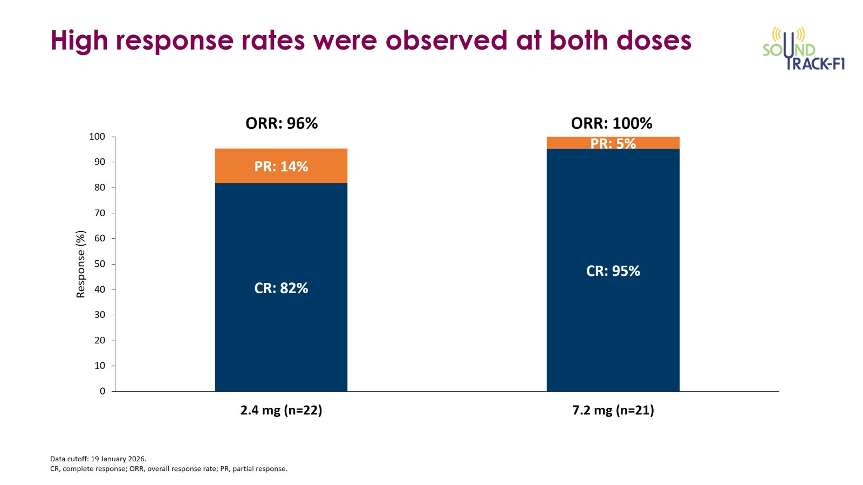
SOUNDTRACK-F1: High Response Rates Across Both Doses
Cheah CY et al. EHA 2026;Abstract S228.

Slide 93
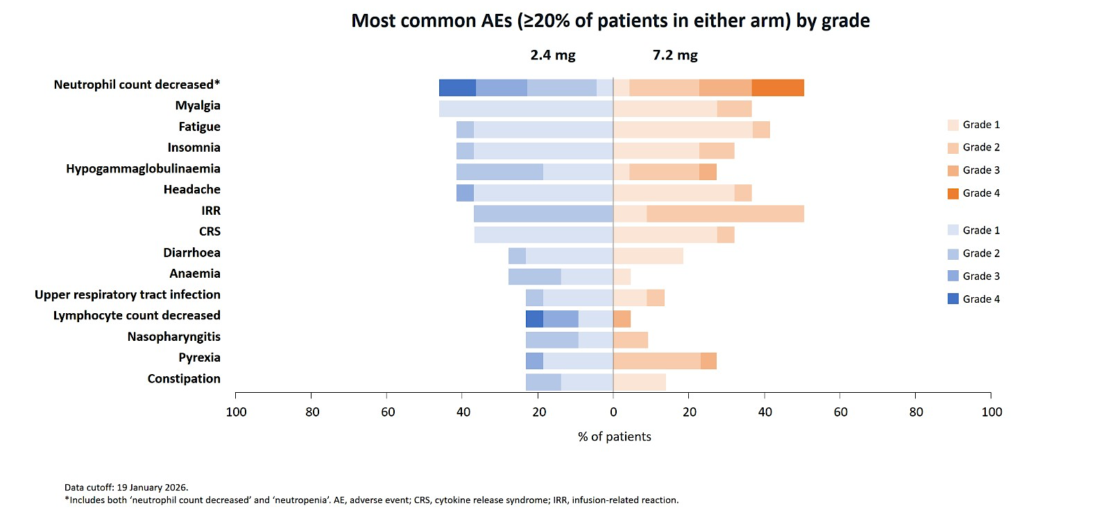
SOUNDTRACK-F1: Safety Summary by Dose Level
Cheah CY et al. EHA 2026;Abstract S228.

Slide 94
Agenda
Module 5: New Bispecific T-Cell Engagers – Surovatamig
Efficacy: Quick MRD-negative durable responses
Toxicity:
  CRS
  ICANS: FL vs large cell lymphoma
  Infections
Case presentation: 57-year-old man
Key ongoing trials
  SOUNDTRACK-F1: Up-front surovatamig/rituximab ± surovatamig maintenance vs chemoimmunotherapy + rituximab maintenance
  SOUNDTRACK-B: Surovatamig monotherapy for R/R FL and R/R DLBCL
  Multinational investigator-initiated study Stage I/II FL: Surovatamig vs involved-site radiation therapy (ISRT) ± rituximab

Slide 95
Agenda
Prologue: Saturday Night Fever
Module 1: Baby Boomers’ Guide to Mechanisms of Action
Module 2: Second-Line Treatment
Module 3: Complications Associated with Bispecific Antibodies
Module 4: Case Presentations
Module 5: New Bispecific T-Cell Engagers – Surovatamig
Module 6: Other Novel Agents

Slide 96
Agenda
Module 6: Other Novel Agents
MK-1045: CD19 x CD3 bispecific antibody
BAFF-R: B-cell activating factor receptor
Case presentation: 88-year-old man – Phase I ATHENA-1 trial of odronextamab + REGN5837 for R/R B-cell lymphoma (Signal 1/Signal 2)

Slide 97
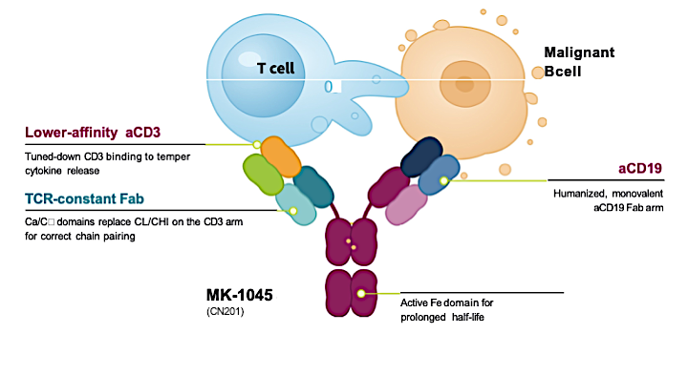
MK-1045: Another CD19xCD3 Candidate
C_{α}/C_{β} domains replace C_{L}/CH₁ on the CD3 arm

Slide 98
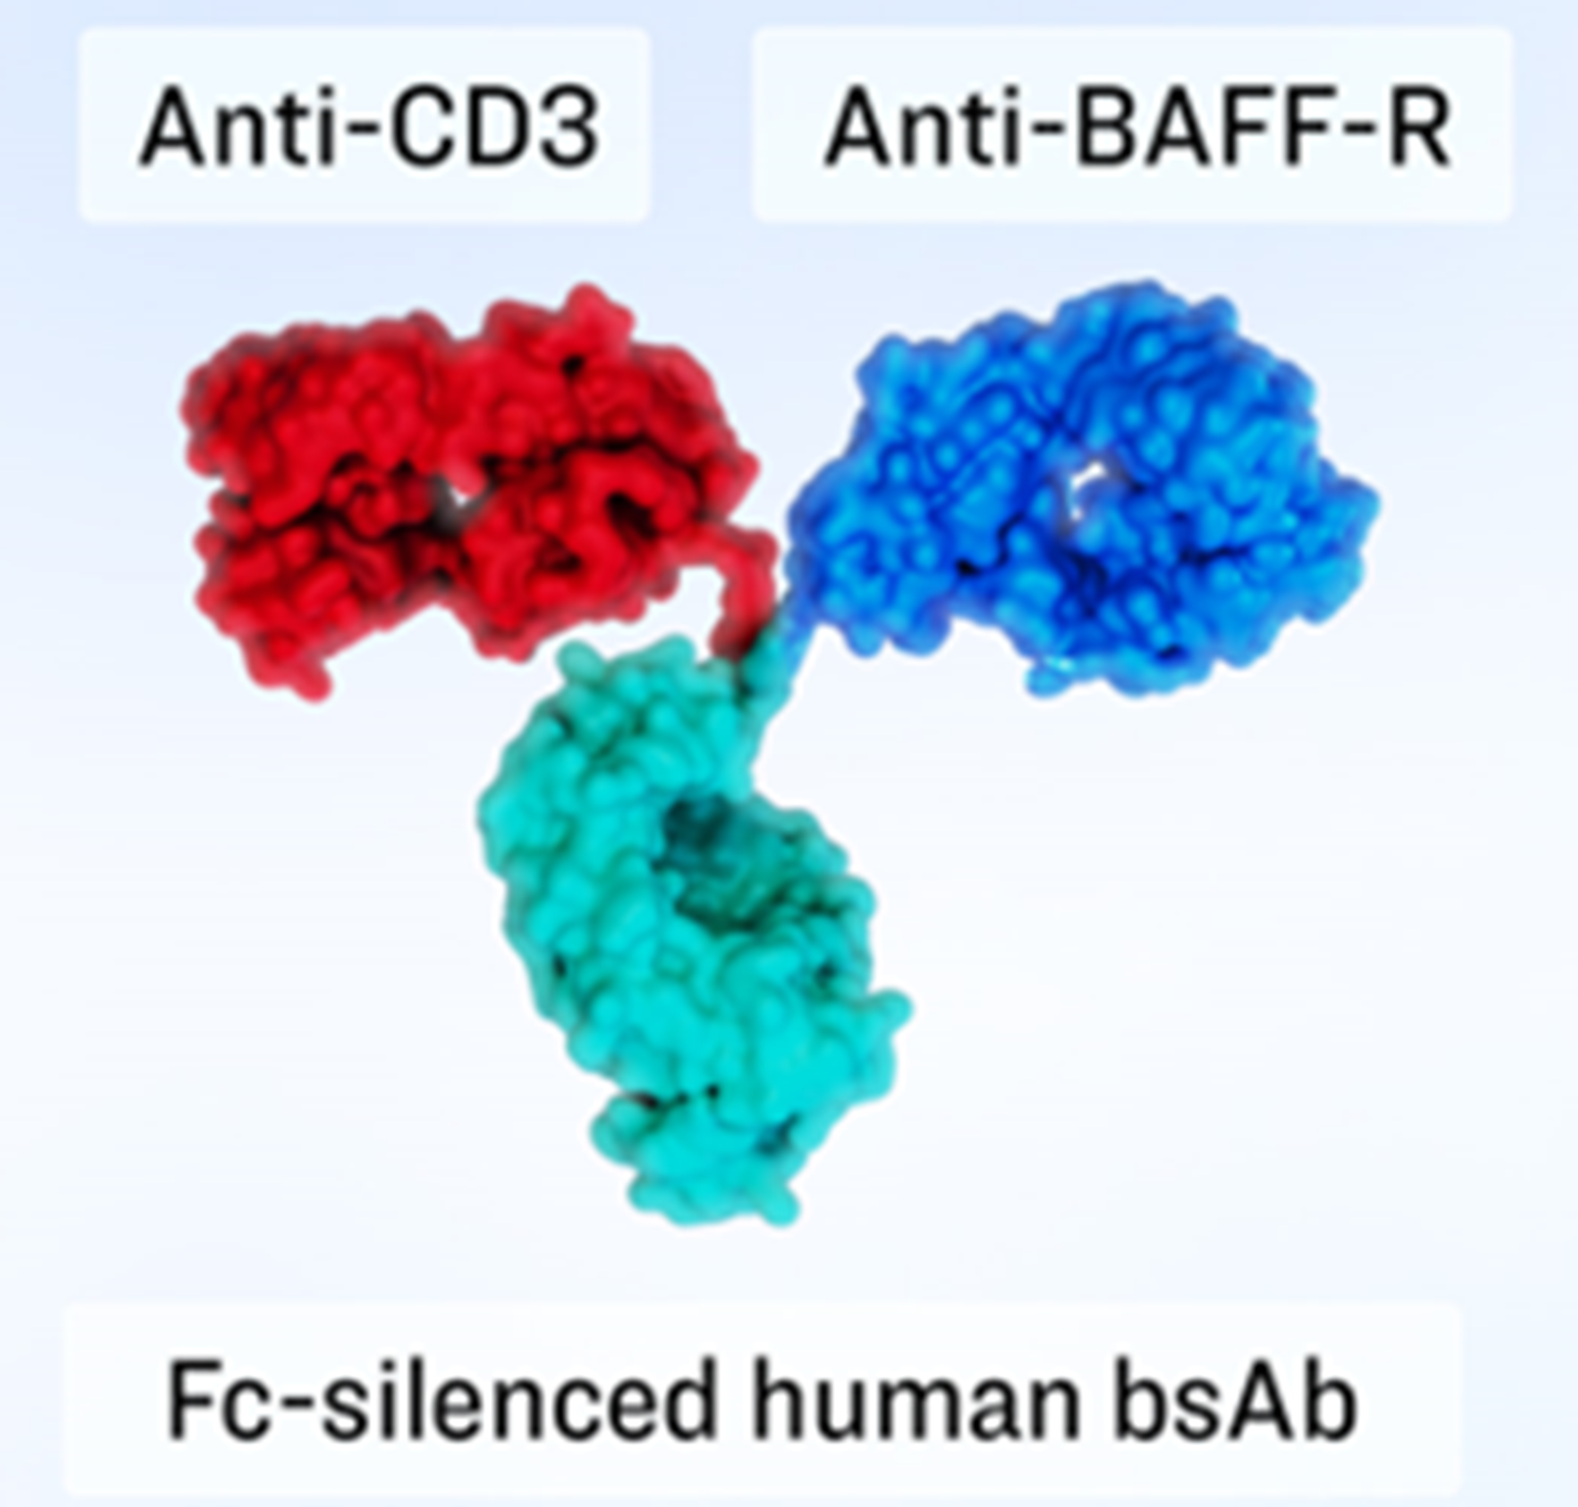
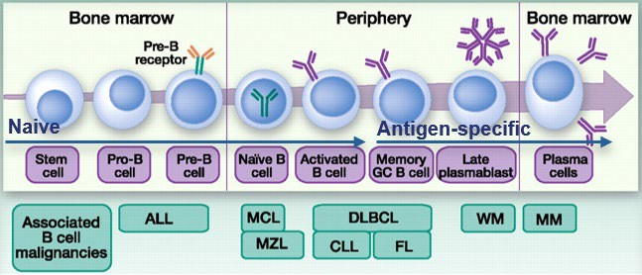
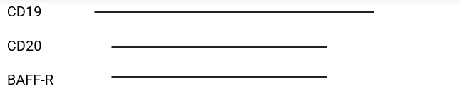
LY4152199: BAFF-R x CD3
BAFF-R (B cell activating factor of the TNF-family receptor) is a surface-expressed B cell marker
BAFF-R is expressed by the majority of B cells and is essential to B-cell development and survival
CD20/CD19 antigen loss may deleteriously affect long-term responses to CD20 and CD19 targeted
therapies
BAFF-R expression is unaffected by CD20/CD19 antigen loss
Novel BAFF-RxCD3 bispecific antibody to treat B-cell malignancies, including rescue of relapsed or refractory cancers previously treated with CD20 and/or CD19 therapies
Modified from Blanc, Bousseau et al. 2011; Marta et al. 2017

Slide 99
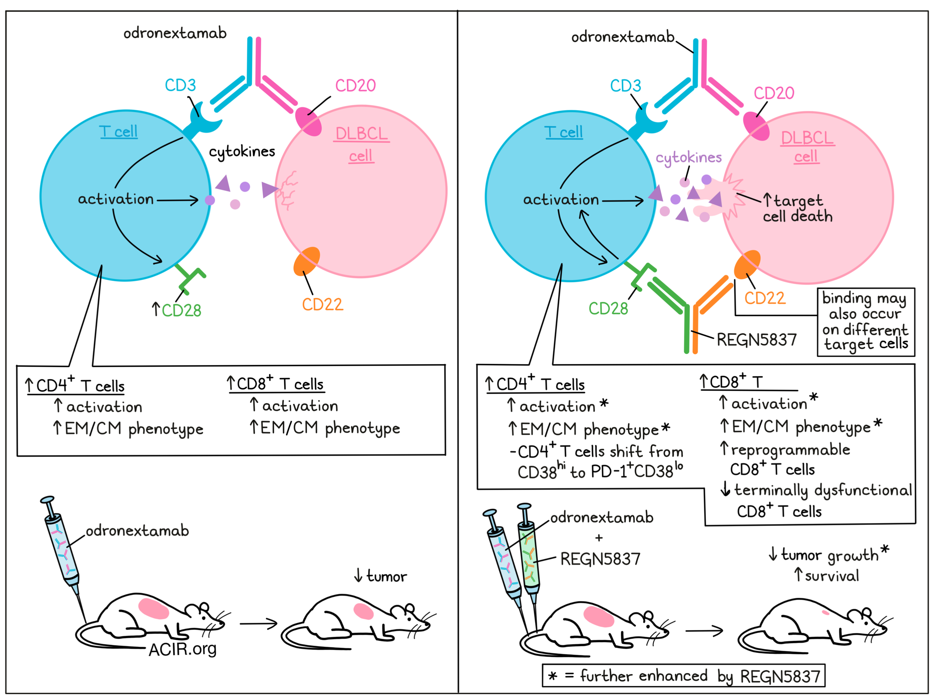
Novel strategy: Dual BsAb to recapitulate signal 1 + signal 2: Odronextamab + REGN5837
Image taken from Acir.org
Wei J et al. Sci Transl Med. 2022

Slide 100
Case Presentation – 88-year-old man
88-year-old man with a history of low-grade FL diagnosed in 2010 at age 76, treated with BR for four cycles, then a brief course of rituximab maintenance. He experienced systemic relapse in 2013, biopsy revealing transformation, and he was treated with RCHOP x6 achieving a CR. He relapsed 5 years later in 2018 with low-grade FL, treated with rituximab and lenalidomide for 9 months achieving a CR and was monitored. Four years later, he received rituximab monotherapy for a systemic relapse, and consolidative RT to the right inguinal region for localized persistent avidity. He presented in April of 2024 with progressive FL causing progressive fatigue, biopsy showed FL, grade 3A.
Reviewed options including clinical trials, and pt preferred ATHENA-1 (odronextamab + REGN5837) over standard of care mosunetuzumab.

Slide 101
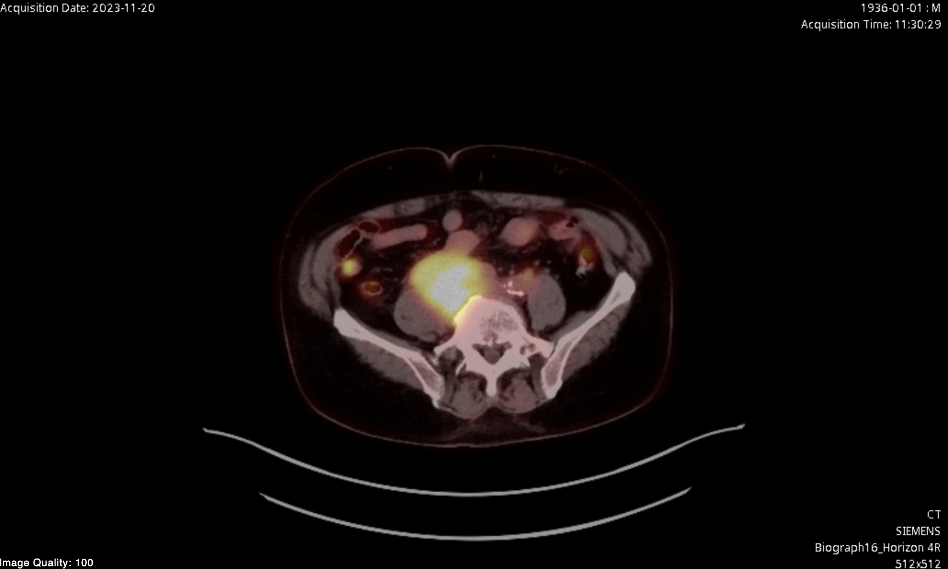
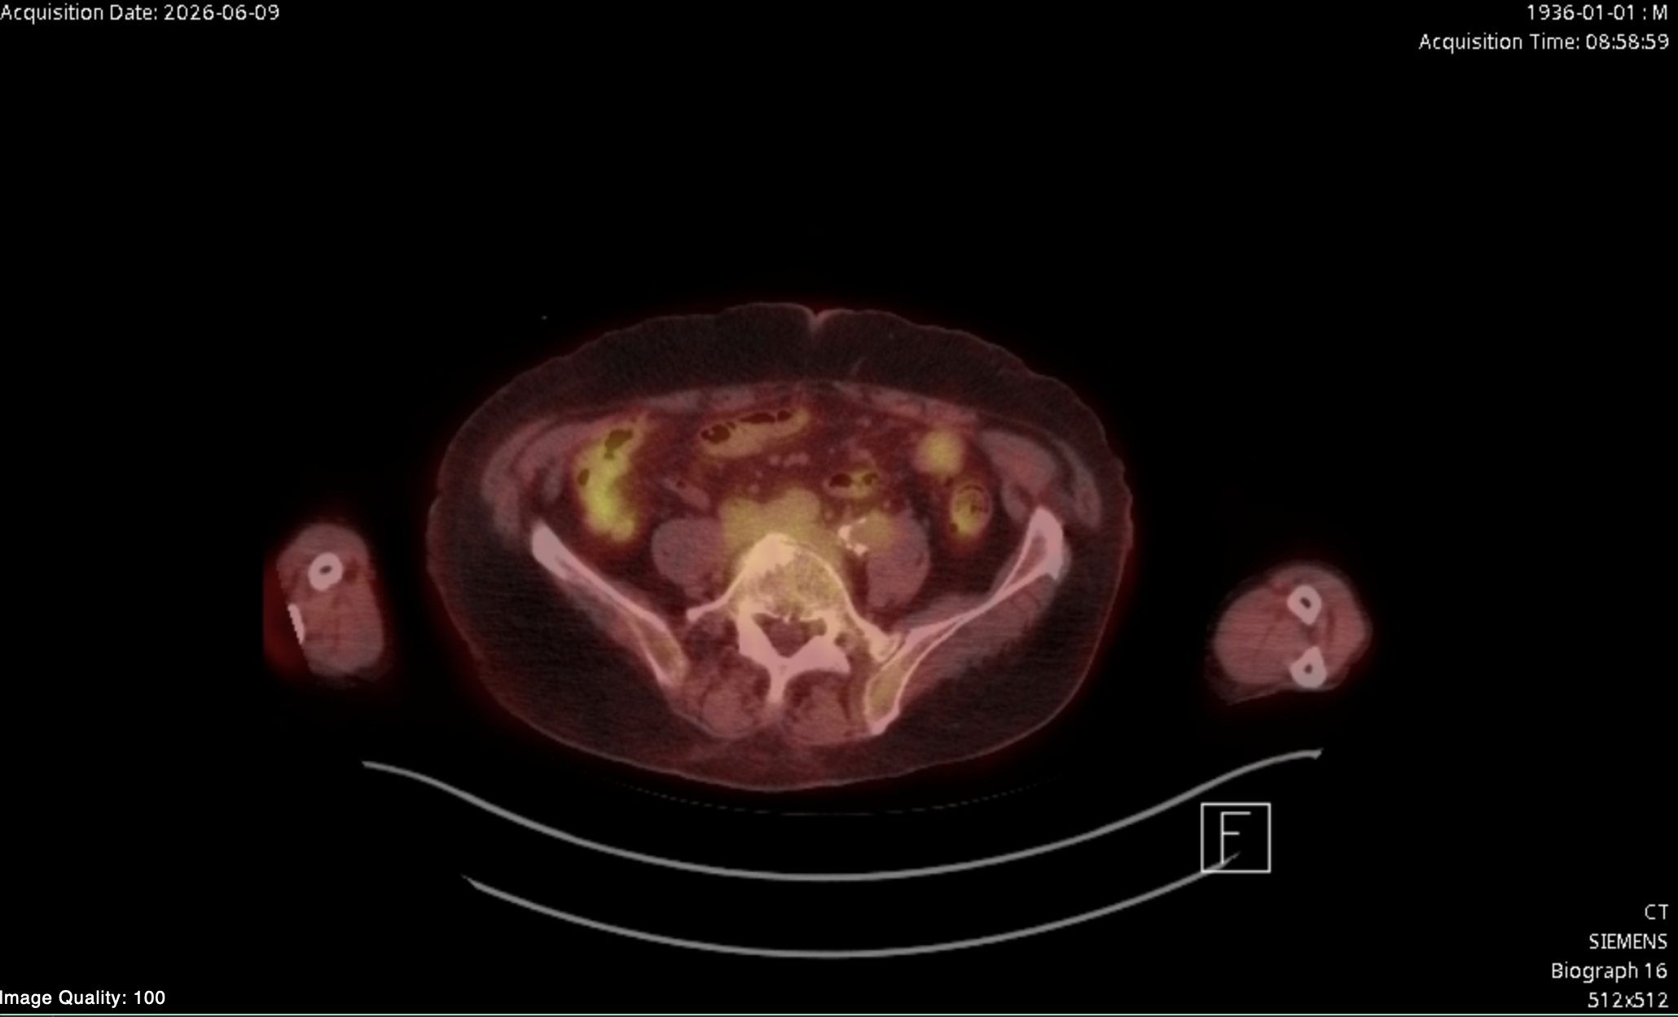
Case Presentation – 88-year-old man
(continued)
Tolerated SUD of odronextamab with only Gr1 CRS, tolerated addition of REGN5837 uneventfully, achieved CR at first response evaluation, continued and completed therapy 4/2026, in ongoing CR subsequently

Slide 102
Agenda
Module 6: Other Novel Agents
MK-1045: CD19 x CD3 bispecific antibody
BAFF-R: B-cell activating factor receptor
Case presentation: 88-year-old man – Phase I ATHENA-1 trial of odronextamab + REGN5837 for R/R B-cell lymphoma (Signal 1/Signal 2)

Slide 103
Cancer Conference Update:
ESMO Congress 2026 Review — Breast Cancer
A CME/MOC-Accredited Live Webinar
Thursday, November 12, 2026
5:00 PM – 6:30 PM ET
Faculty
Professor Giuseppe Curigliano, MD, PhD
Rebecca A Dent, MD, MSc
Komal Jhaveri, MD, FACP, FASCO
Moderator
Neil Love, MD

Slide 104
Thank you for joining us!
Please take a moment to complete the survey currently up on Zoom. Your feedback is very important to us.
The survey will remain open for
5 minutes after the meeting ends.
Information on how to obtain CME and ABIM MOC credit is provided in the Zoom chat room.
Attendees will also receive an email in 1 to 3 business days with these instructions.

