Slide 1


The Potential Role of PD-1 x VEGF Bispecific
Antibodies in the Management of Non-Small Cell
Lung Cancer: Translating Emerging Evidence into
Community Oncology Practice
Bilawal Ahmed, MD
Assistant Professor of Medicine
Division of Hematology and Oncology
The University of Tennessee Health Science Center
Memphis, Tennessee

Slide 2






Contributing Clinical Investigators
Christina Baik, MD, MPH
Thoracic, Head and Neck Medical Oncology
University of Washington School of Medicine
Fred Hutchinson Cancer Research Center
Seattle, Washington
Antonio Passaro, MD, PhD
Director
Division of Thoracic Oncology
European Institute of Oncology
Milan, Italy
Jonathan Goldman, MD
Professor of Medicine, UCLA Hematology and Oncology
Director of Clinical Trials in Thoracic Oncology
Associate Director of Drug Development
UCLA Health
Santa Monica, California
Zofia Piotrowska, MD, MHS
Associate Professor of Medicine
Harvard Medical School
Clinical Co-Director, MGB Thoracic Medical Oncology Program
Massachusetts General Brigham Cancer Institute
Boston, Massachusetts
Paul K Paik, MD
Attending Physician
Clinical Director, Thoracic Oncology Service
Memorial Sloan Kettering Cancer Center
New York, New York
Julia Rotow, MD
Assistant Professor of Medicine
Harvard Medical School
Clinical Director, Director of Clinical Research
Lowe Center for Thoracic Oncology
Boston, Massachusetts

Slide 3
Learning Objectives
Appraise the scientific rationale for the development of bispecific antibodies directed at PD-1 and VEGF, and understand the mechanism of action and the similarities and differences among the various investigational agents in this class.
Evaluate the documented efficacy of PD-1 x VEGF bispecific antibodies in combination with chemotherapy for patients with progressive EGFR-mutated metastatic non-small cell lung cancer (NSCLC), and consider the potential role of these agents.
Review published research findings with PD-1 x VEGF bispecific antibodies alone and in combination with chemotherapy as first-line therapy for patients with metastatic NSCLC without actionable genomic alterations, and reflect on ongoing trials attempting to further validate the effectiveness of these strategies.
Recognize the spectrum, frequency and severity of toxicities associated with PD-1 x VEGF bispecific antibodies, and appreciate management strategies to facilitate the safe and effective administration of these agents.

Slide 4
Accreditation Statement
Research To Practice is accredited by the Accreditation Council for Continuing Medical Education (ACCME) to provide continuing medical education for physicians.
Credit Designation Statement
Research To Practice designates this live activity for a maximum of 0.5 AMA PRA Category 1 CreditsTM. Physicians should claim only the credit commensurate with the extent of their participation in the activity.

Slide 5
Content Validation and Disclosures
Research To Practice (RTP) is committed to providing its participants with high-quality, unbiased and state-of-the-art education and adheres to the ACCME’s Standards for Integrity and Independence in Accredited Continuing Education. Any individuals in a position to control the content of an accredited continuing education activity, including faculty, planners, reviewers and others, are required to disclose all relevant financial relationships with ineligible entities (commercial interests). All relevant financial relationships have been mitigated prior to the commencement of this activity. In addition, all activity content is reviewed by RTP scientific staff and an external, independent physician reviewer for fair balance, scientific objectivity of studies referenced and patient care recommendations.

Slide 6
Dr Ahmed — Disclosures
Faculty
No relevant financial relationships to disclose.

Slide 7
Contributing Clinical Investigators — Disclosures
Prof Passaro has no relevant financial relationships to disclose. The following faculty reported relevant financial relationships with ineligible entities:
Dr Baik — Consulting Agreements: AstraZeneca Pharmaceuticals LP, Bayer HealthCare Pharmaceuticals, Boehringer Ingelheim Pharmaceuticals Inc, Daiichi Sankyo Inc, Janssen Biotech Inc, Lilly, Natera Inc, Nuvalent, Pfizer Inc, Regeneron Pharmaceuticals Inc, Takeda Pharmaceuticals USA Inc, UCB Japan; Research Funding (to Institution): AbbVie Inc, AstraZeneca Pharmaceuticals LP, Avenzo Therapeutics, Black Diamond Therapeutics Inc, BlossomHill Therapeutics, Blueprint Medicines, Boehringer Ingelheim Pharmaceuticals Inc, Bristol Myers Squibb, Daiichi Sankyo Inc, Ellipses Pharma, Genentech, a member of the Roche Group, Janssen Biotech Inc, Lilly, Nuvalent, Pfizer Inc, Summit Therapeutics, Syntrix Biosystems, SystImmune Inc; Nonrelevant Financial Relationships: Bristol Myers Squibb Foundation. Dr Goldman — Consulting Agreements: AbbVie Inc, Amgen Inc, AstraZeneca Pharmaceuticals LP, Bristol Myers Squibb, Genentech, a member of the Roche Group, Janssen Biotech Inc, Lilly, Pfizer Inc, Summit Therapeutics; Contracted Research: AbbVie Inc, Agenus Inc, Amgen Inc, Astellas, AstraZeneca Pharmaceuticals LP, Bristol Myers Squibb, Genentech, a member of the Roche Group, GSK, Janssen Biotech Inc, Lilly, Merck, Pfizer Inc, Puma Biotechnology Inc, RayzeBio, Summit Therapeutics, Tango Therapeutics; Honoraria: AbbVie Inc, AstraZeneca Pharmaceuticals LP, Genentech, a member of the Roche Group, Lilly, Summit Therapeutics; Research Grants: AbbVie Inc, Amgen Inc, Astellas, AstraZeneca Pharmaceuticals LP, GSK, Summit Therapeutics, Tango Therapeutics. Dr Paik — Advisory Committees: EMD Serono Inc, Janssen Biotech Inc, Summit Therapeutics; Consulting Agreements: AbbVie Inc, EMD Serono Inc; Contracted Research: Bicara Therapeutics, EMD Serono Inc, Novartis, Nuvectis Pharma Inc, Summit Therapeutics. Dr Piostrowska — Consulting Agreements: AbbVie Inc, AstraZeneca Pharmaceuticals LP, Bayer HealthCare Pharmaceuticals, Black Diamond Therapeutics Inc, BlossomHill Therapeutics, Boehringer Ingelheim Pharmaceuticals Inc, Daiichi Sankyo Inc, Genentech, a member of the Roche Group, Genmab US Inc, Gilead Sciences Inc, Janssen Biotech Inc, Lilly, Natera Inc, Nuvalent, Regeneron Pharmaceuticals Inc, Revolution Medicines Inc, Summit Therapeutics, Taiho Oncology Inc, Takeda Pharmaceuticals USA Inc, Tubulis; Contracted Research: AbbVie Inc, AstraZeneca Pharmaceuticals LP, BlossomHill Therapeutics, Blueprint Medicines, Cullinan Therapeutics, Daiichi Sankyo Inc, GSK, Janssen Biotech Inc, Novartis, Nuvalent, Nuvectis Pharma Inc, Spectrum Pharmaceuticals Inc, SystImmune Inc, Takeda Pharmaceuticals USA Inc, Tesaro, A GSK Company; Data and Safety Monitoring Boards/Committees: Genentech, a member of the Roche Group. Dr Rotow — Consulting Agreements: AbbVie Inc, Amgen Inc, AstraZeneca Pharmaceuticals LP, BioAtla, BioNTech SE, BlossomHill Therapeutics, Boehringer Ingelheim Pharmaceuticals Inc, Bristol Myers Squibb, Caris Life Sciences, Catalyst Pharmaceuticals Inc, Daiichi Sankyo Inc, G1 Therapeutics Inc, Genentech, a member of the Roche Group, Gilead Sciences Inc, Guardant Health, Jazz Pharmaceuticals Inc, Johnson & Johnson, Merus, Novocure Inc, Nuvalent, Nuvation Bio Inc, Ottimo Pharma, Pfizer Inc, Regeneron Pharmaceuticals Inc, Sanofi, Summit Therapeutics, Takeda Pharmaceuticals USA Inc; Contracted Research (All to Institution): AbbVie Inc, AstraZeneca Pharmaceuticals LP, Bicycle Therapeutics, BioAtla, BioNTech SE, Black Diamond Therapeutics Inc, BlossomHill Therapeutics, Blueprint Medicines, Bristol Myers Squibb, Daiichi Sankyo Inc, Duality Biologics, Enliven Therapeutics, EpimAb Biotherapeutics Inc, ImmunityBio, Loxo Oncology Inc, a wholly owned subsidiary of Eli Lilly & Company, Nuvalent, ORIC Pharmaceuticals, RedCloud Bio, Regeneron Pharmaceuticals Inc, Summit Therapeutics, Synthekine; Honoraria: AstraZeneca Pharmaceuticals LP, Daiichi Sankyo Inc, Johnson & Johnson, Pfizer Inc.

Slide 8
Commercial Support
This activity is supported by an educational grant from Summit Therapeutics.
Research To Practice CME Planning Committee Members,
Staff and Reviewers
Planners, scientific staff and independent reviewers for Research To Practice have no relevant financial relationships to disclose.

Slide 9
This educational activity contains discussion of
non-FDA-approved uses of agents and regimens. Please refer to official prescribing information for each product for approved indications.

Slide 10
Agenda
Module 1: Ivonescimab for Previously Untreated Metastatic Non-Small Cell Lung Cancer (mNSCLC)
Module 2: Ivonescimab for Relapsed/Refractory EGFR-Mutated mNSCLC
Module 3: Other Novel PD-1/PD-L1 x VEGF Bispecific Antibodies Under Investigation

Slide 11
Agenda
Module 1: Ivonescimab for Previously Untreated Metastatic Non-Small Cell Lung Cancer (mNSCLC)
Module 2: Ivonescimab for Relapsed/Refractory EGFR-Mutated mNSCLC
Module 3: Other Novel PD-1/PD-L1 x VEGF Bispecific Antibodies Under Investigation

Slide 12
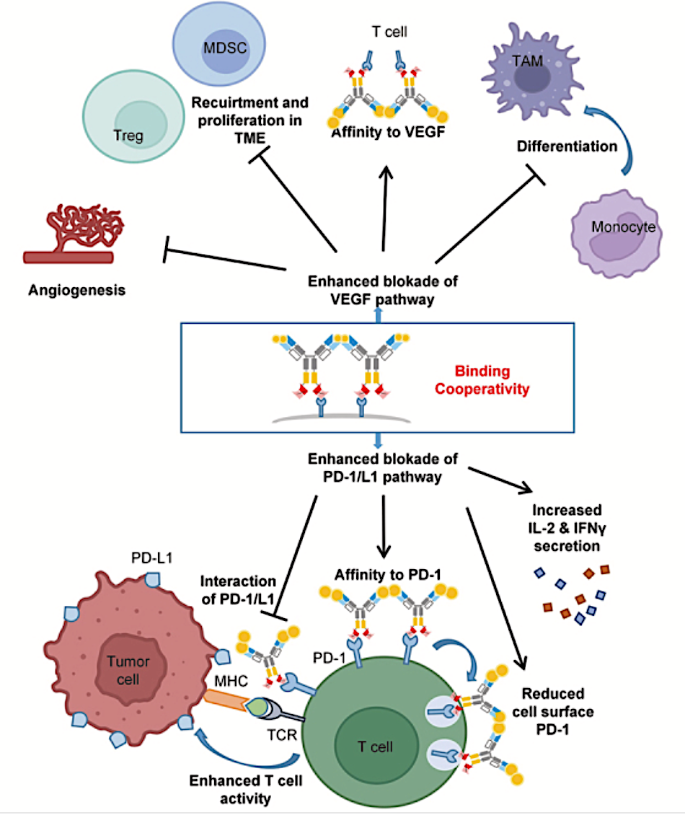
Rationale for Dual Targeting of PD-1/PD-L1 and VEGF
Recruitment and
proliferation in
TME
By blocking both PD-1/PD-L1 and VEGF in the tumor microenvironment (TME), bispecific antibodies have the potential to drive synergistic antitumor activity through higher binding affinity and increased activity of T cells
In vitro studies have demonstrated that the presence of VEGF increased PD-1 binding strength more than tenfold
Enhanced blockade of
Enhanced blockade of
Zhong T et al. iScience 2024;28(3):111722.
Zhang J et al. ASCO 2025;Abstract TPS8664.

Slide 13
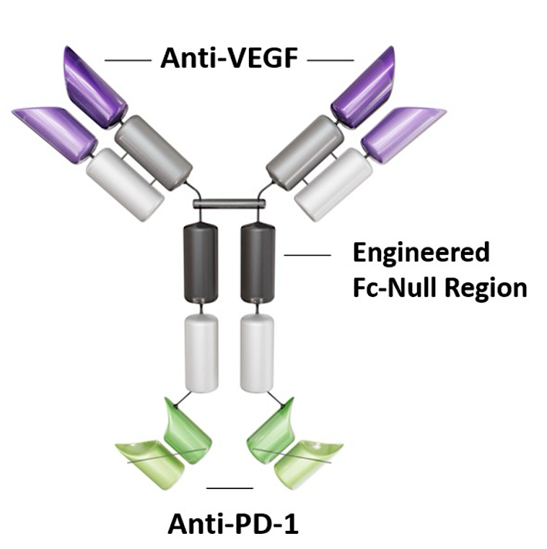
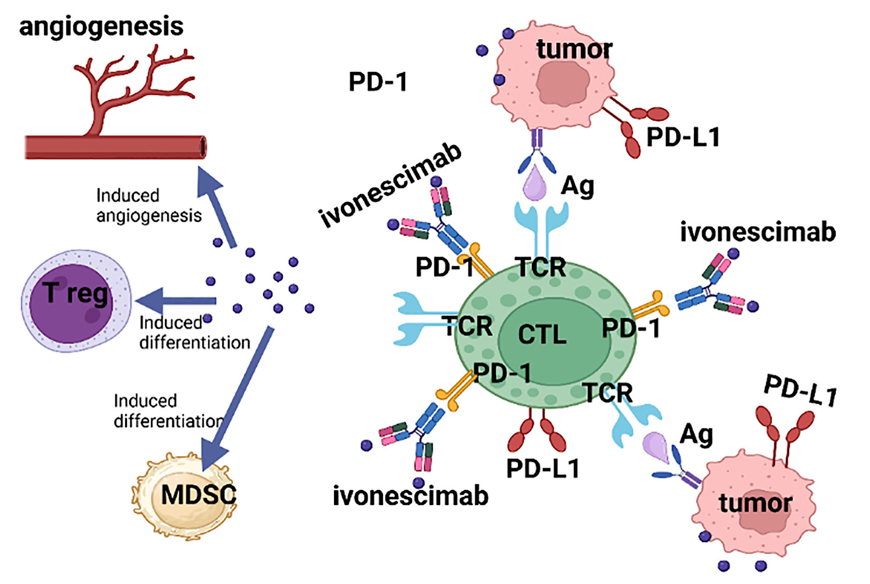
Ivonescimab Mechanism of Action
Zhang L et al. ASCO 2024;Abstract 8508.

Slide 14
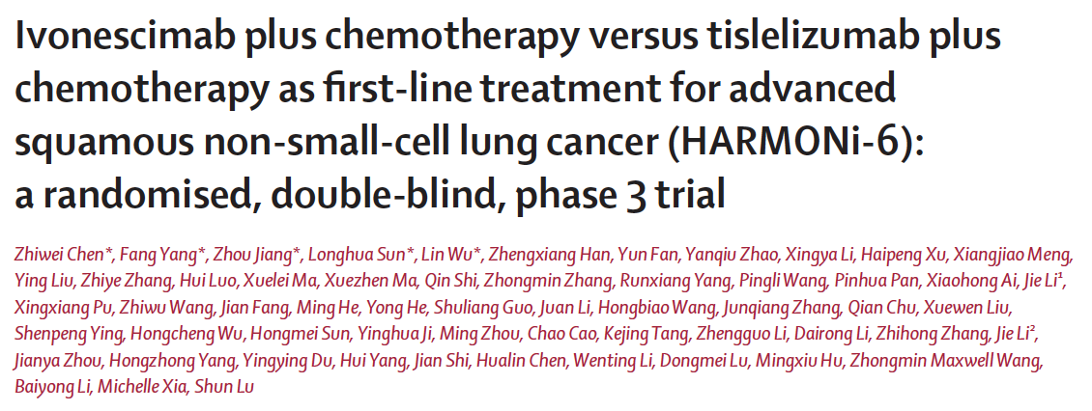
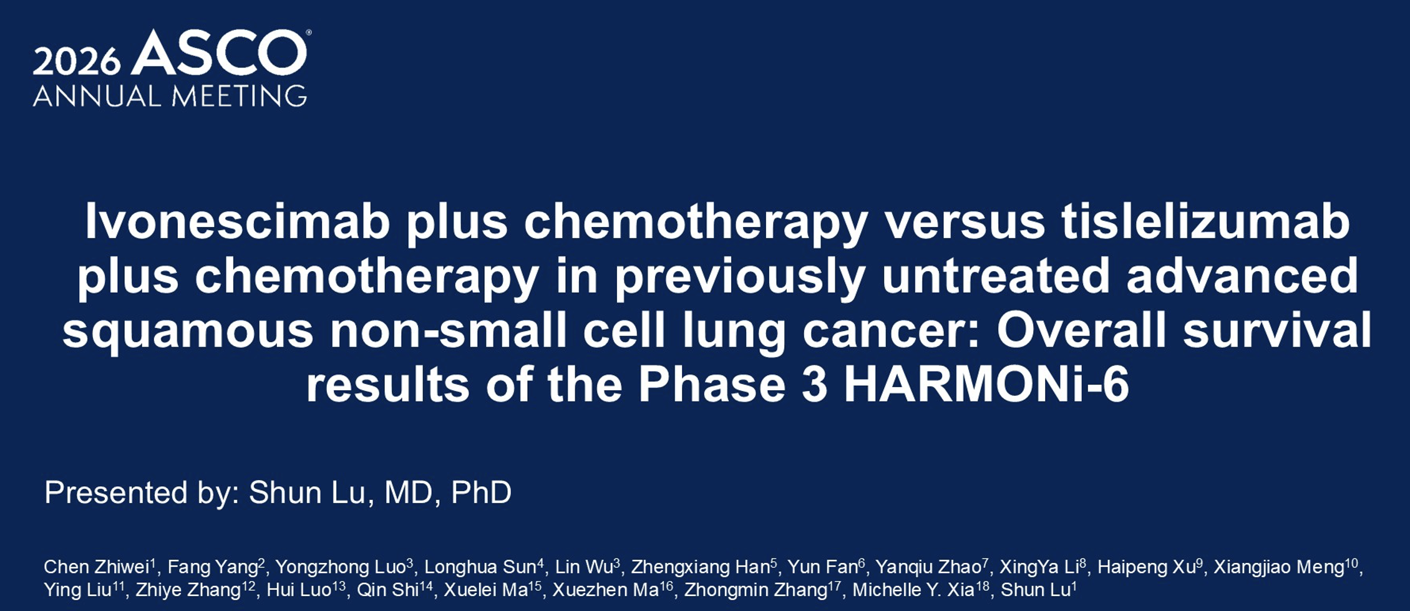
Abstract LBA4
Lancet 2025;406:2078-88.
trial

Slide 15
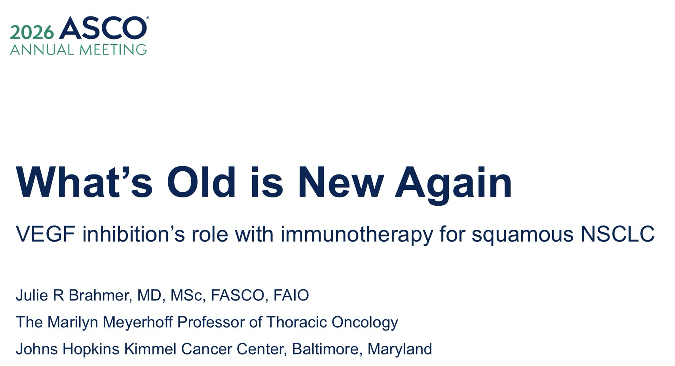

Slide 16
Will PD-1/VEGF Bispecific Antibodies Replace Immune Checkpoint Inhibitors for Some, Many or All Patients?
Immune checkpoint inhibitor | Approval date
Nivolumab | 2015
Pembrolizumab | 2015
Atezolizumab | 2016
Durvalumab | 2018
Ipilimumab | 2020
Cemiplimab | 2021
Tremelimumab | 2022

Slide 17
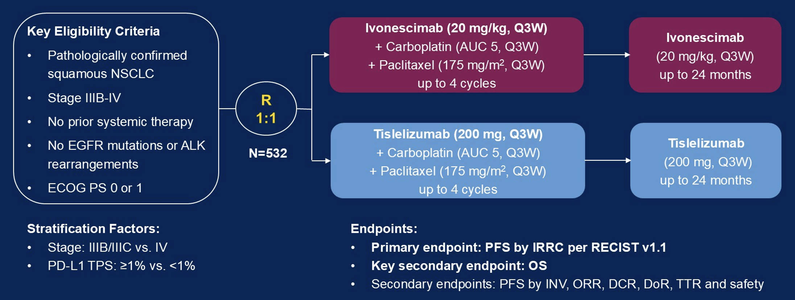
HARMONi-6 Chinese Phase III Study Design
Zhiwei C et al. ASCO 2026;Abstract LBA4.

Slide 18
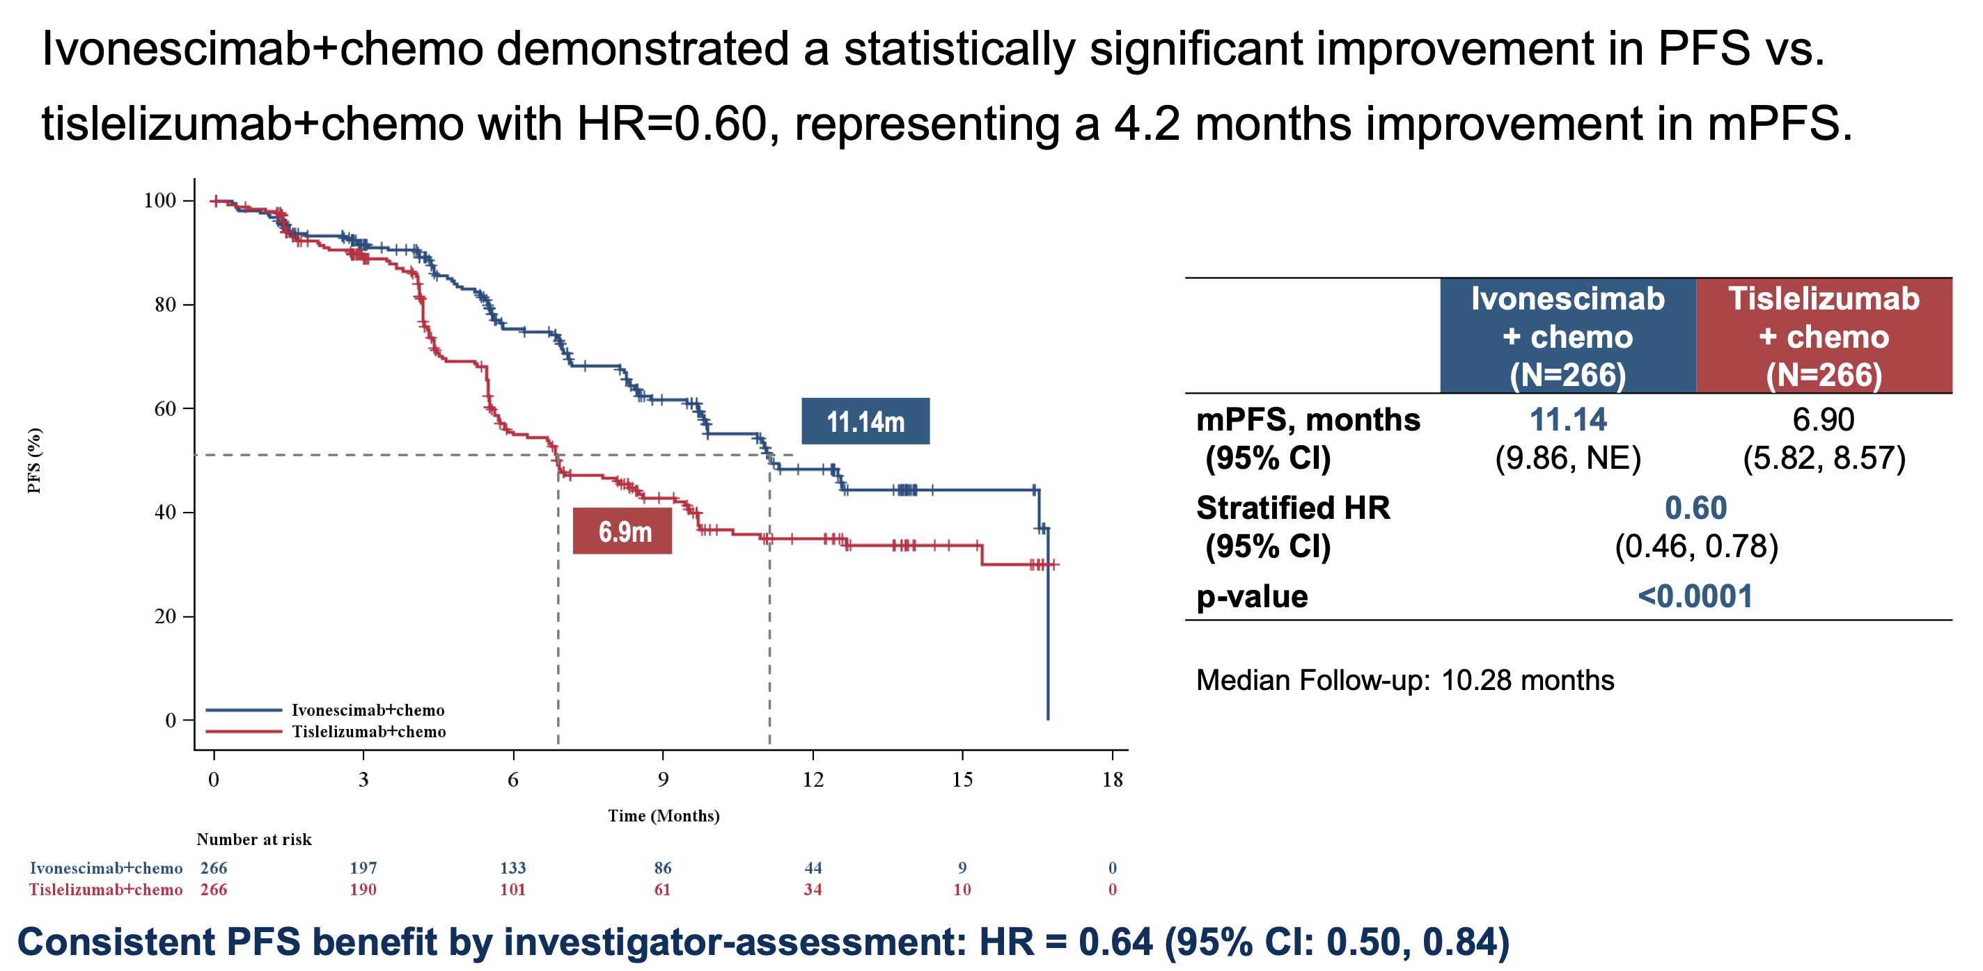
HARMONi-6: Progression-Free Survival (PFS) Outcomes
Ivonescimab + chemo demonstrated a statistically significant improvement in PFS vs. tislelizumab + chemo with HR = 0.60, representing a 4.2-month improvement in mPFS.
mPFS = median PFS
Lu S et al. ESMO 2025;Abstract LBA4.

Slide 19
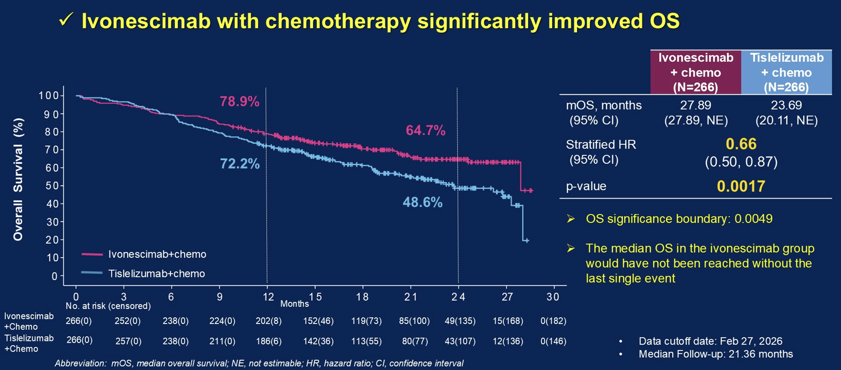
HARMONi-6: Interim Overall Survival (OS) Analysis
Zhiwei C et al. ASCO 2026;Abstract LBA4.

Slide 20
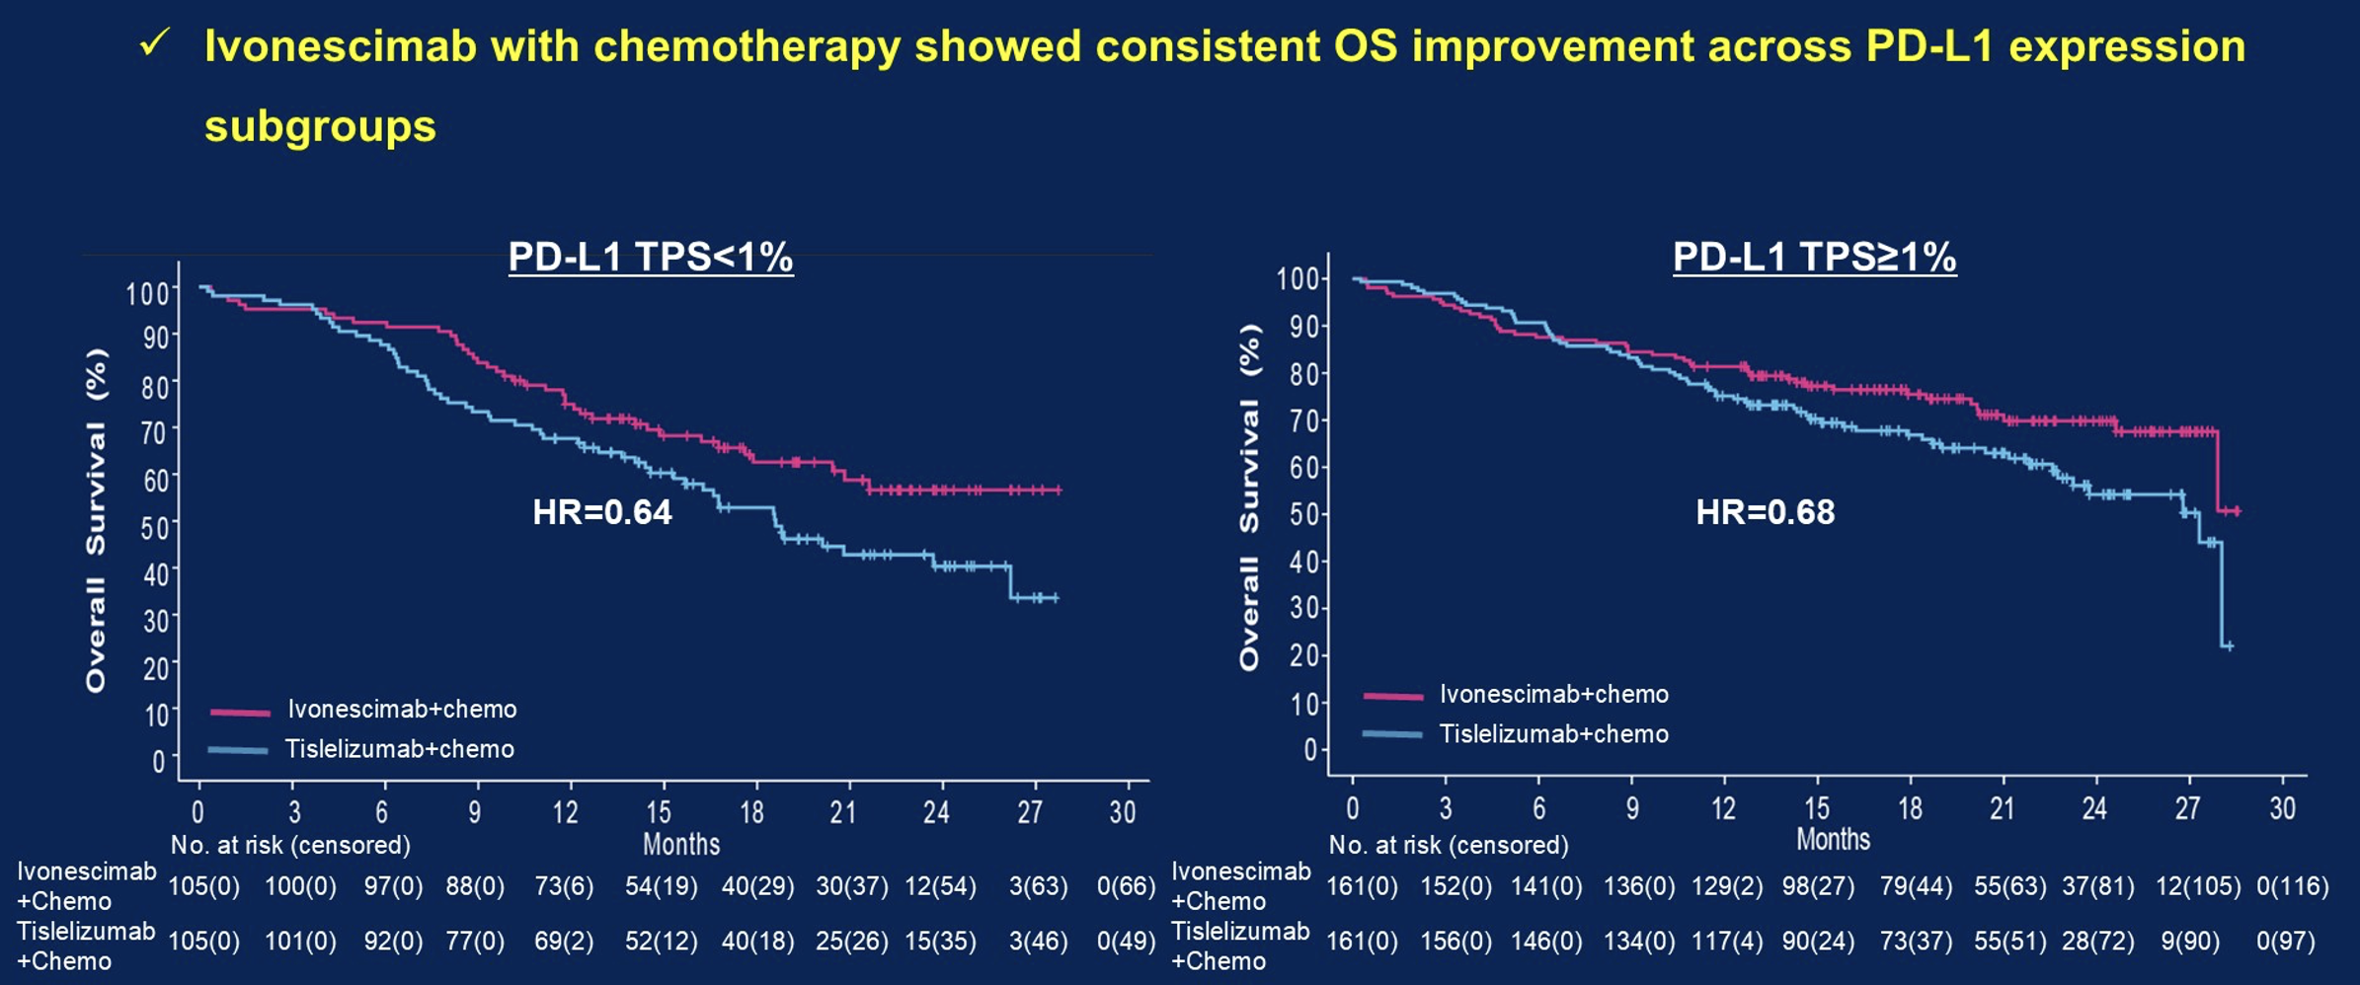
HARMONi-6: OS by PD-L1 Expression Levels
Zhiwei C et al. ASCO 2026;Abstract LBA4.

Slide 21
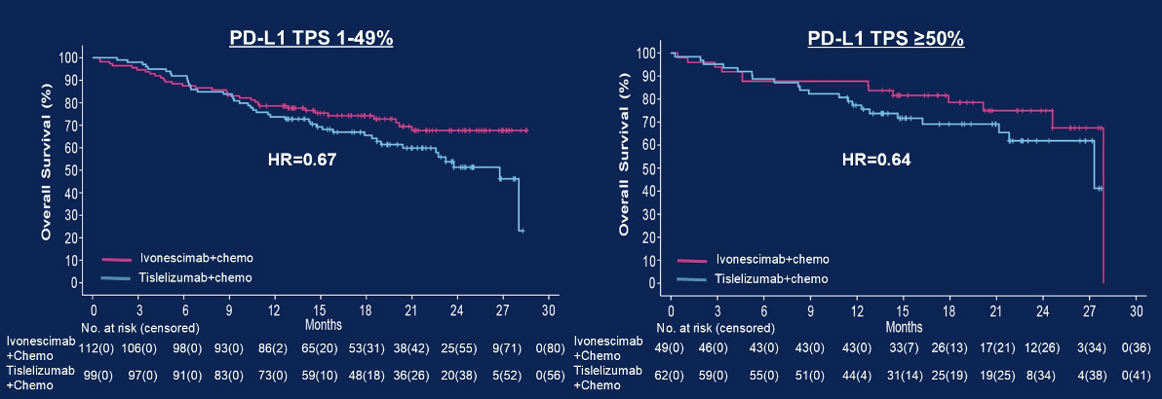
HARMONi-6: OS by PD-L1 Expression Levels
Zhiwei C et al. ASCO 2026;Abstract LBA4.

Slide 22
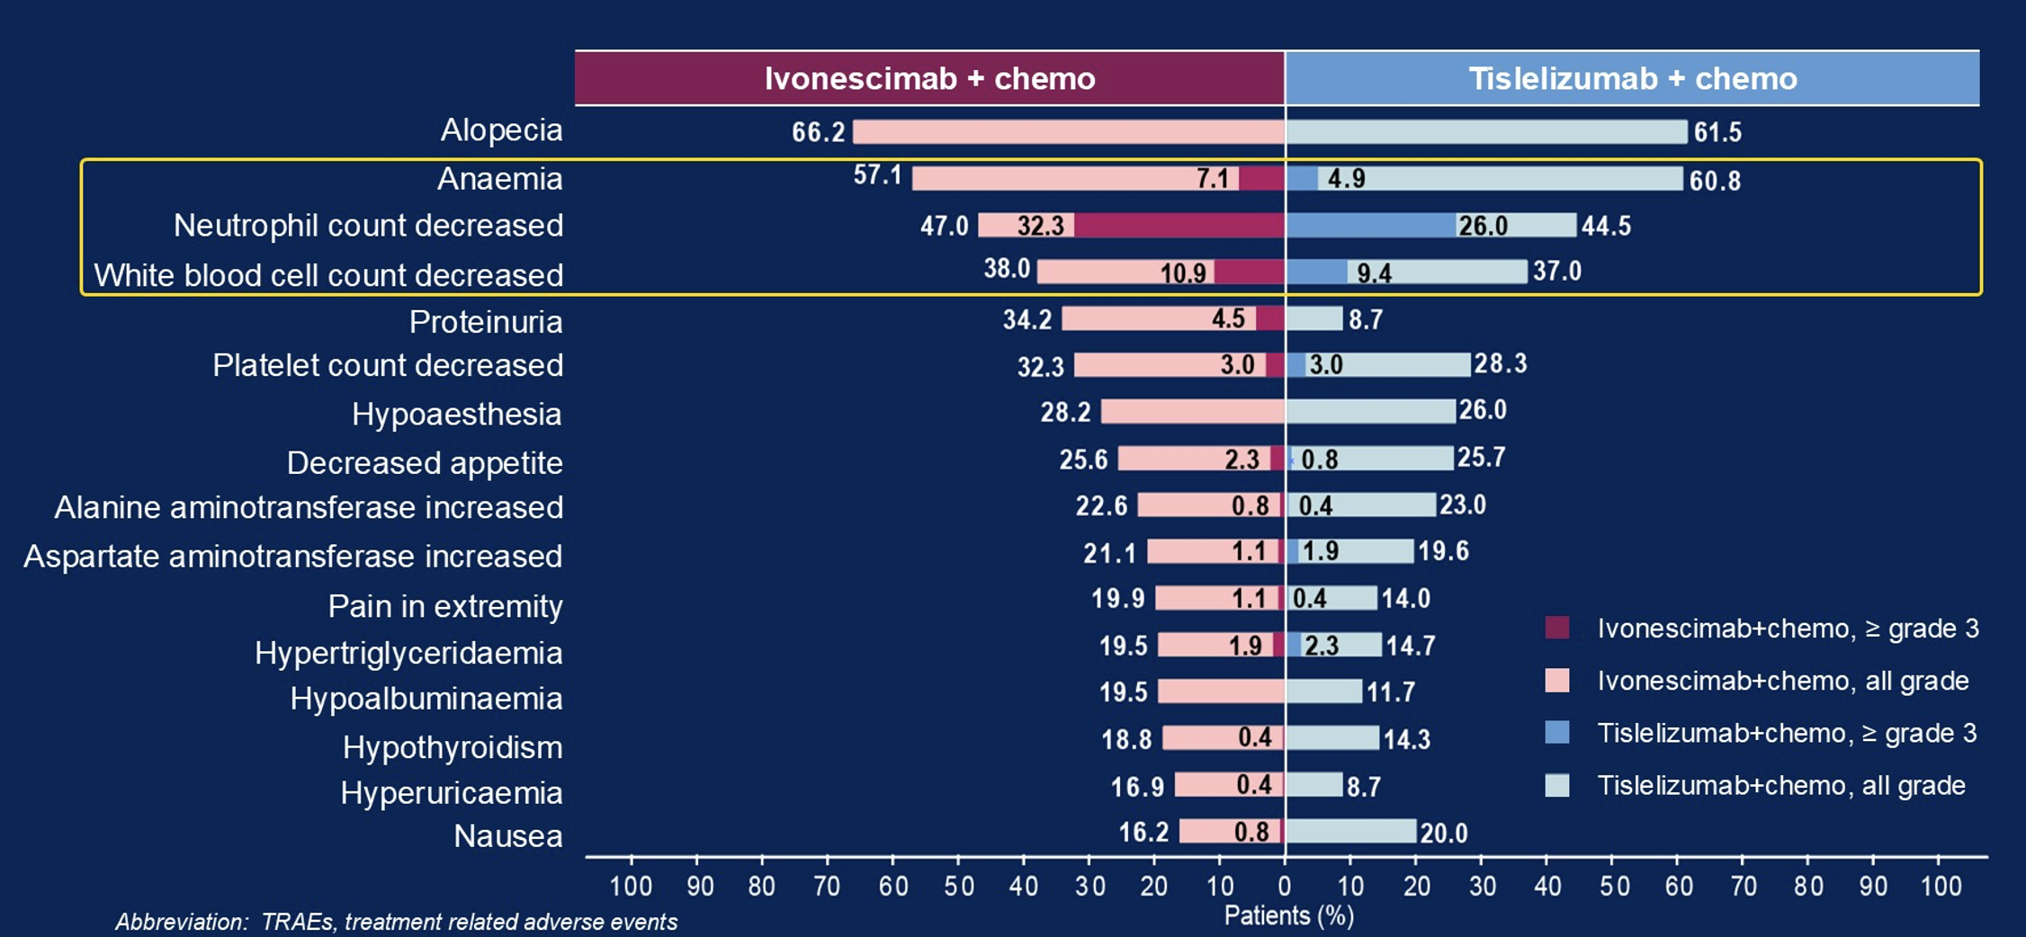
HARMONi-6: Safety Profile
Grade ≥3 immune-related adverse events (AEs) were observed in 34 (14%) of patients receiving ivonescimab/chemotherapy and in 36 (14%) of patients receiving tislelizumab/chemotherapy.
Zhiwei C et al. ASCO 2026;Abstract LBA4.

Slide 23
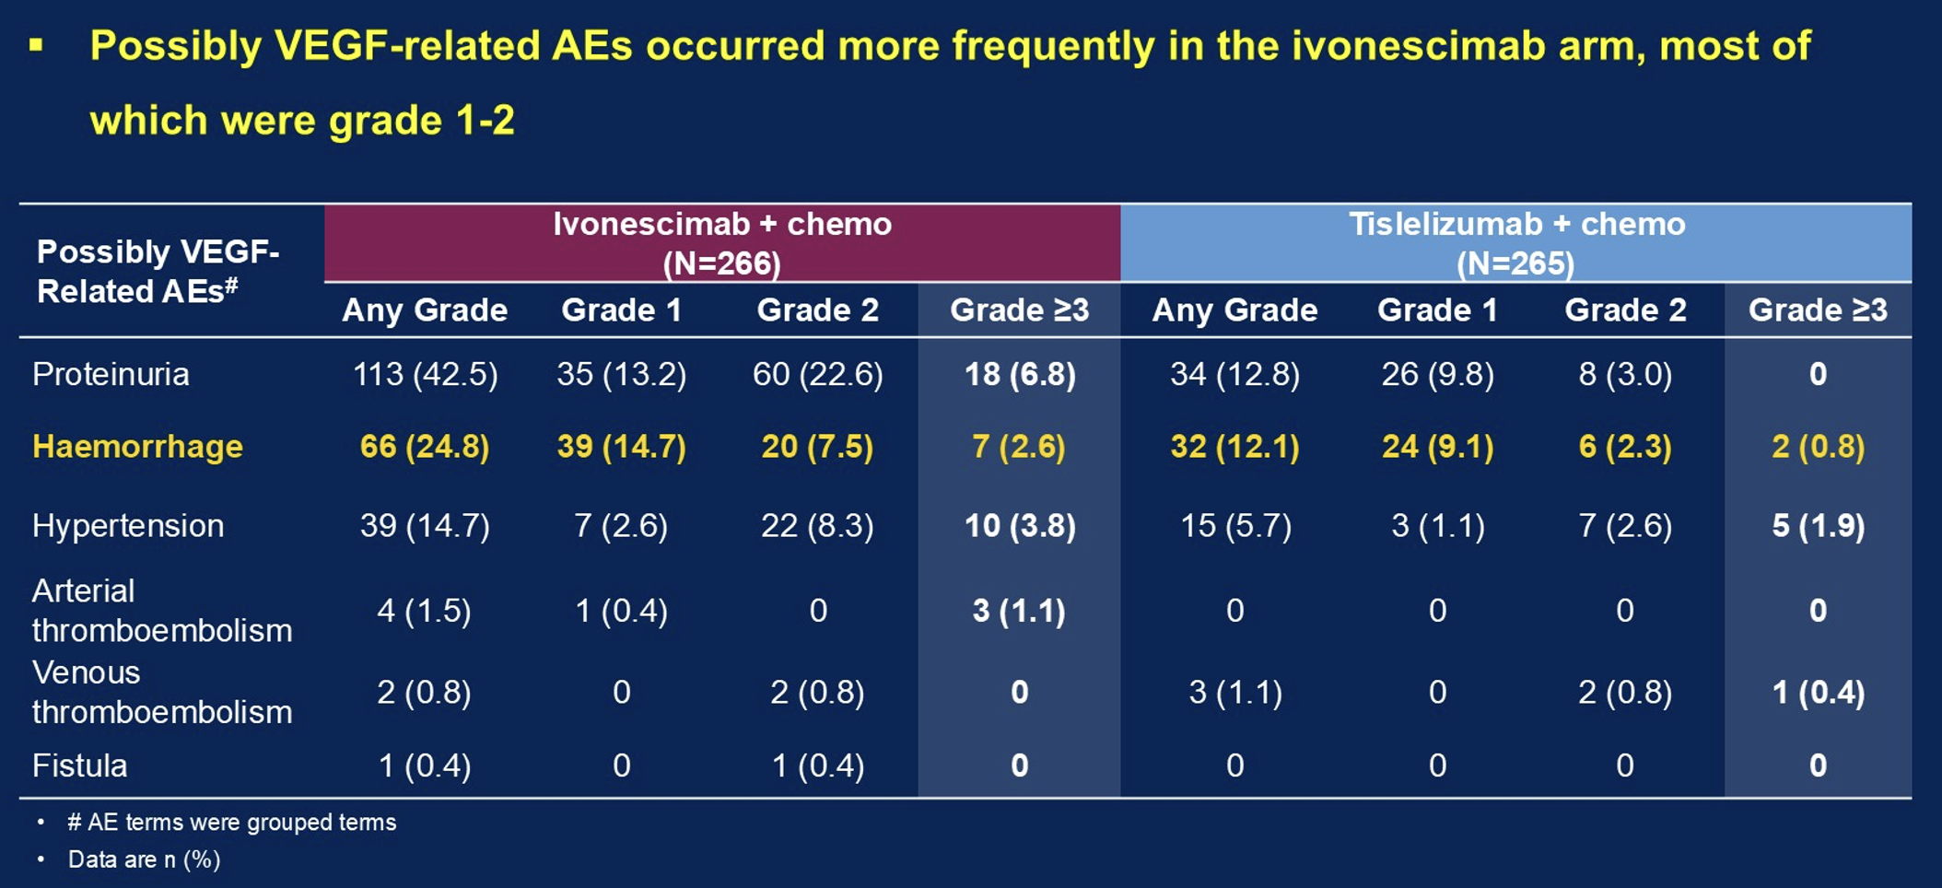
HARMONi-6: Possibly VEGF-Related Adverse Events (AEs)
Zhiwei C et al. ASCO 2026;Abstract LBA4.

Slide 24
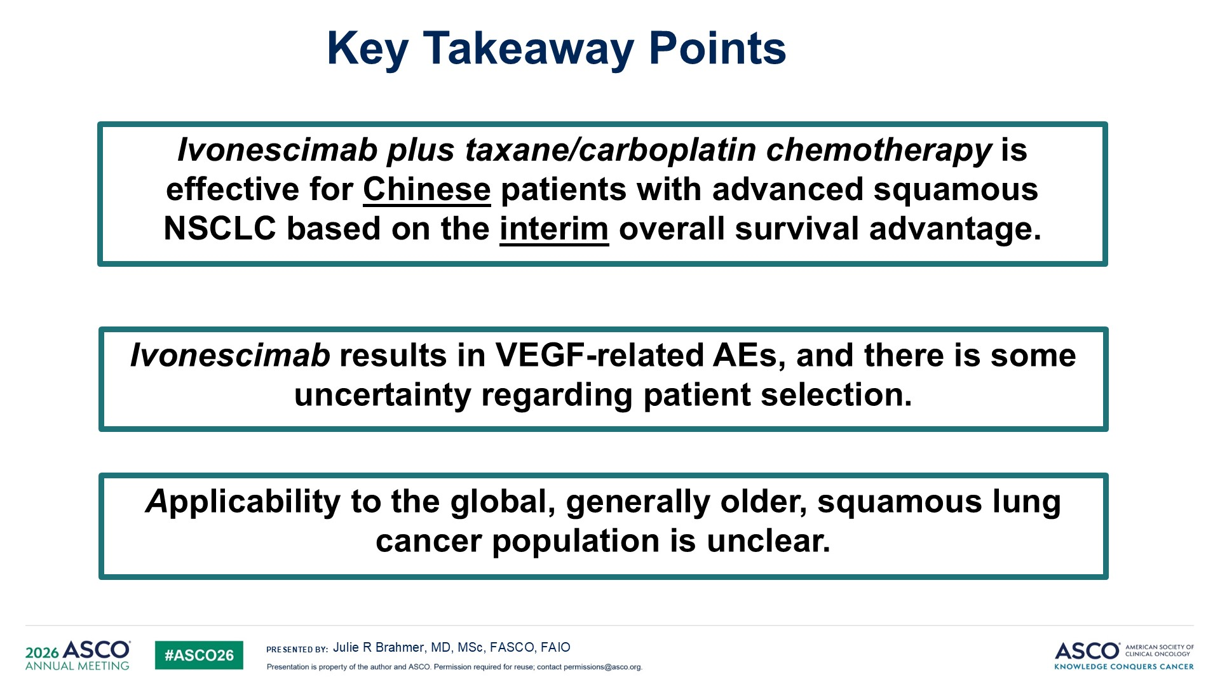
Applicability
Content of this presentation is the property of the author, licensed by ASCO. Permission required for reuse.

Slide 25
“We have to wait and see if ivonescimab will be approved in squamous cell. If they approve it in the EU based on HARMONi-6 and we don’t, and then years down the line, it turns out to be the same in the US, we will regret that, and our patients would have been getting inferior care, which has never happened. We’re always the first, so how can we be the last? So that’s a big deal.”
Stephen V Liu, MD
Oncology Today Podcast with Dr Neil Love

Slide 26
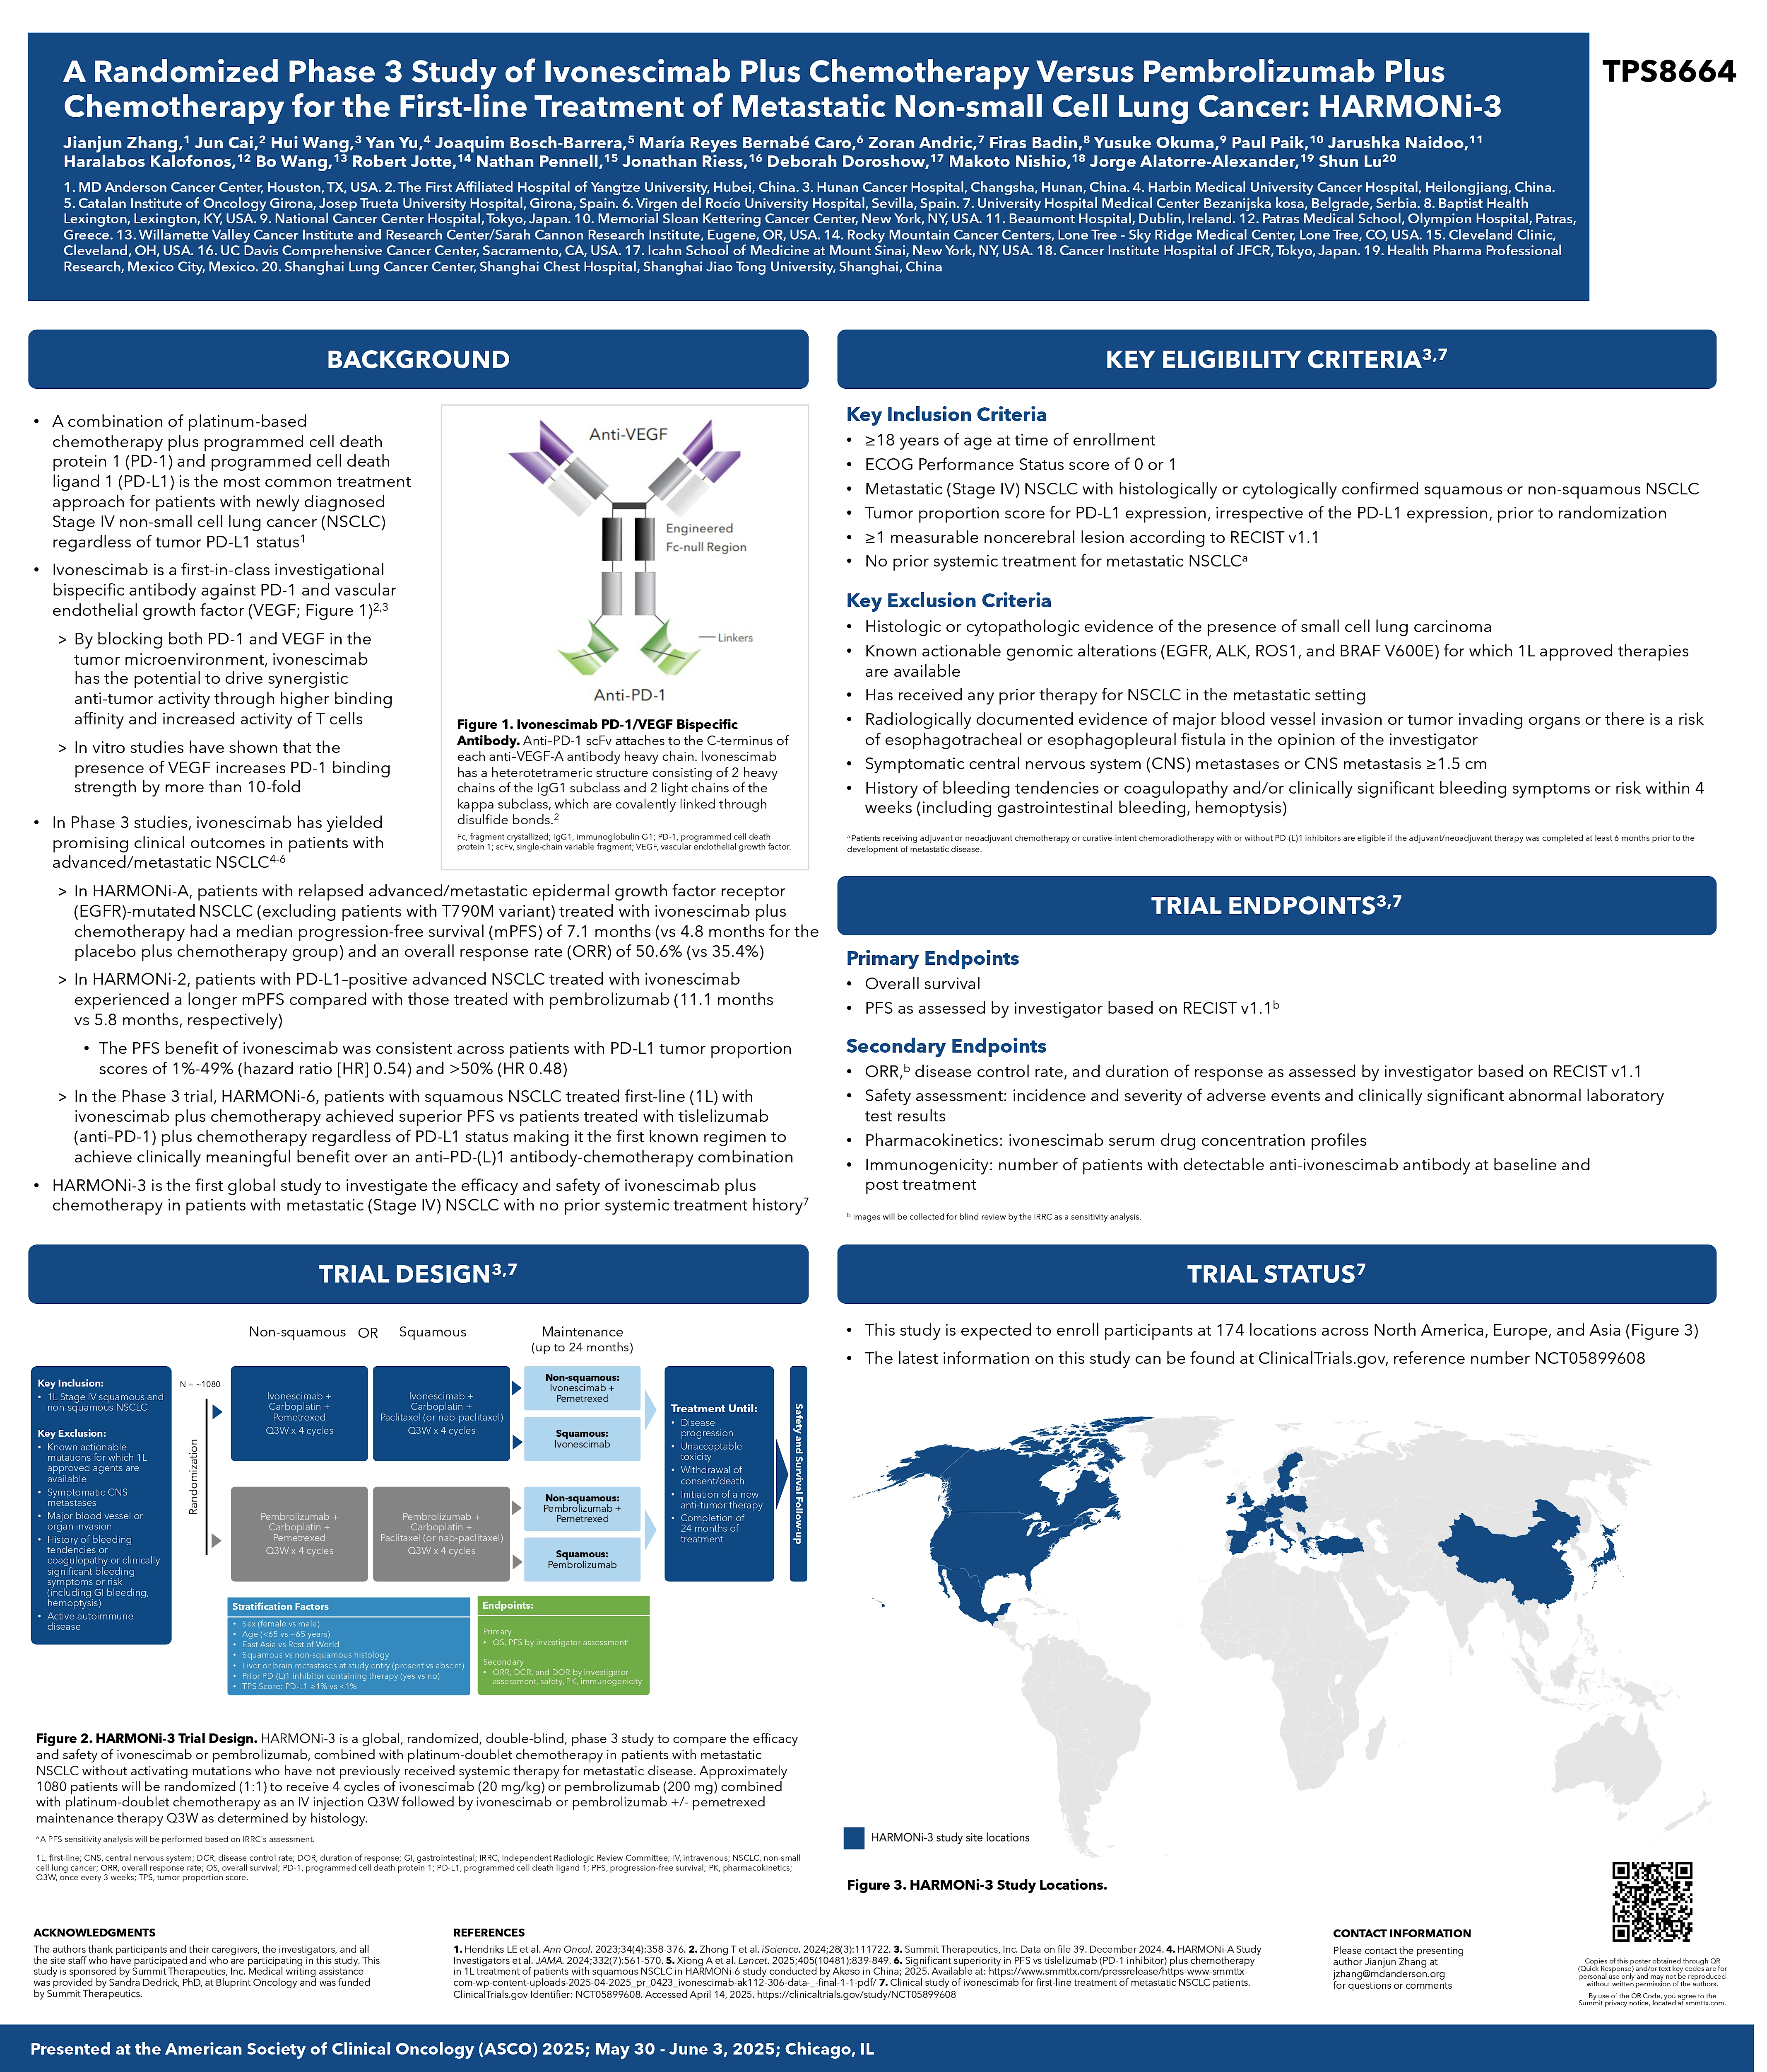
HARMONi-3: An Ongoing Phase III Study of Ivonescimab/Chemotherapy versus Pembrolizumab/Chemotherapy for Previously Untreated mNSCLC
Zhang J et al. ASCO 2025;Abstract TPS8664.

Slide 27
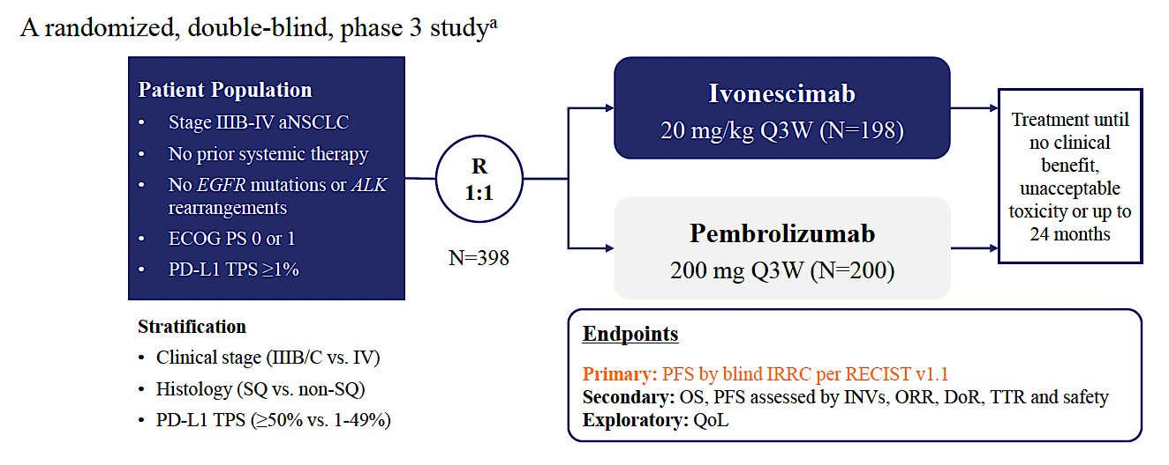
HARMONi-2 Chinese Phase III Study Design
Zhou C et al. WCLC 2024;Abstract PL02.04.

Slide 28
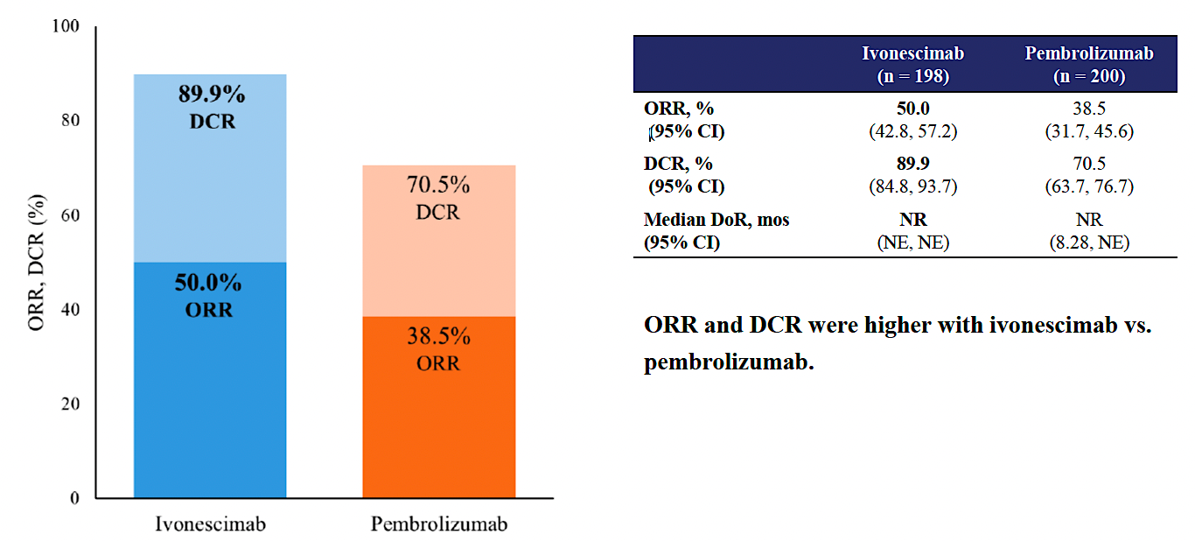
HARMONi-2: Response Data
ORR = objective response rate; DCR = disease control rate; DoR = duration of response
Zhou C et al. WCLC 2024;Abstract PL02.04.

Slide 29
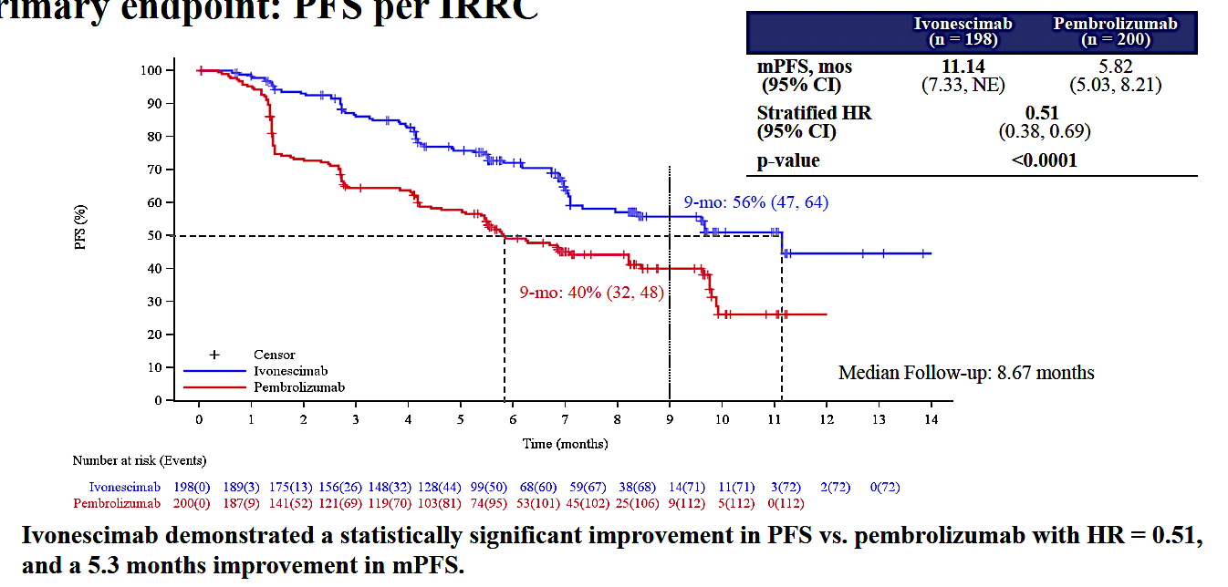
HARMONi-2: PFS Outcomes
Zhou C et al. WCLC 2024;Abstract PL02.04.

Slide 30
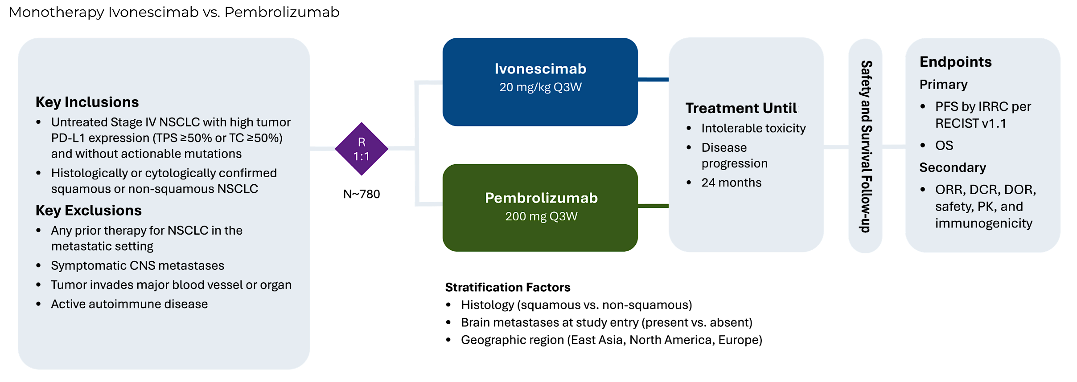
HARMONi-7: An Ongoing Phase III Study of Ivonescimab versus Pembrolizumab for mNSCLC with High PD-L1 Expression
Passaro A et al. ELCC 2025;Abstract 133TiP.

Slide 31
Do you anticipate that ivonescimab/chemotherapy will yield superior efficacy outcomes compared to pembrolizumab/chemotherapy in previously untreated advanced NSCLC in a global population?
Yes
Yes
Yes
I’m not sure
Yes
Yes
I’m not sure

Slide 32
Do you anticipate that ivonescimab monotherapy will yield superior efficacy outcomes compared to pembrolizumab monotherapy in previously untreated advanced NSCLC with high PD-L1 expression in a global population?
Yes
Yes
Yes
I’m not sure
Yes
Yes
I’m not sure

Slide 33
According to clinical trial data and/or your clinical experience, how much of a concern are treatment-related adverse events for patients receiving ivonescimab?
A minor concern; the majority of patients experience
low-grade side effects related to VEGF pathway inhibition
A minor concern; the majority of patients experience low-grade side effects related to VEGF pathway inhibition
A minor concern; the majority of patients experience low-grade side effects related to VEGF pathway inhibition
Minimal concern; the majority of patients experience no side effects
A minor concern; the majority of patients experience low-grade side effects related to VEGF pathway inhibition
A minor concern; the majority of patients experience low-grade side effects related to VEGF pathway inhibition
A minor concern; the majority of patients experience low-grade side effects related to VEGF pathway inhibition

Slide 34
How would you indirectly compare the spectrum and severity of VEGF-related toxicities associated with ivonescimab to those experienced by patients with NSCLC receiving VEGF/VEGFR-targeted monoclonal antibodies?
VEGF-related toxicities are about the same
VEGF-related toxicities are more common/severe
with VEGF/VEGFR-targeted monoclonal antibodies
VEGF-related toxicities are more common/severe
with VEGF/VEGFR-targeted monoclonal antibodies
VEGF-related toxicities are about the same
VEGF-related toxicities are more common/severe
with VEGF/VEGFR-targeted monoclonal antibodies
VEGF-related toxicities are about the same
Not enough data are available to tell

Slide 35
How would you indirectly compare the spectrum and severity of immune-related toxicities associated with ivonescimab to those experienced by patients with NSCLC receiving PD-1/PD-L1-targeted monoclonal antibodies?
Immune-related toxicities are about the same
Immune-related toxicities are about the same
Immune-related toxicities are more common/severe with PD-1/PD-L1-targeted monoclonal antibodies
Immune-related toxicities are about the same
Immune-related toxicities are about the same
Immune-related toxicities are about the same
Immune-related toxicities are about the same

Slide 36
Agenda
Module 1: Ivonescimab for Previously Untreated Metastatic Non-Small Cell Lung Cancer (mNSCLC)
Module 2: Ivonescimab for Relapsed/Refractory EGFR-Mutated mNSCLC
Module 3: Other Novel PD-1/PD-L1 x VEGF Bispecific Antibodies Under Investigation

Slide 37
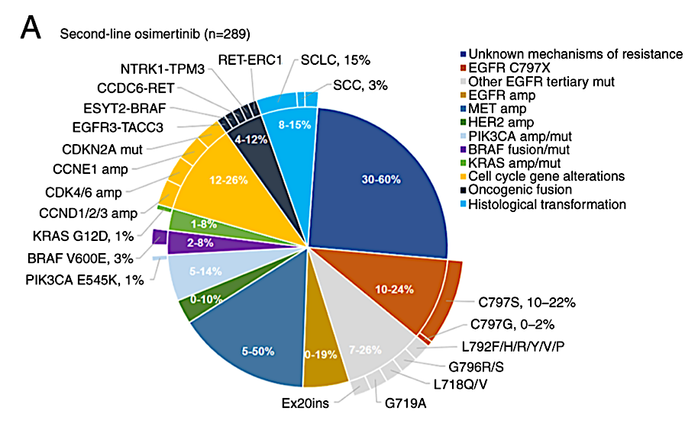
Acquired Resistance in EGFR-Mutated NSCLC
The occurrence of acquired resistance is inevitable, and the mechanisms of third‑generation EGFR tyrosine kinase inhibitor (TKI) resistance are complex and incompletely understood
The mechanisms of acquired resistance to third‑generation EGFR TKIs include an altered EGFR signaling pathway, aberrant activation of bypass and downstream signaling pathways and histological transformation
He J et al. Int J Oncol 2021;59(5):90.

Slide 38
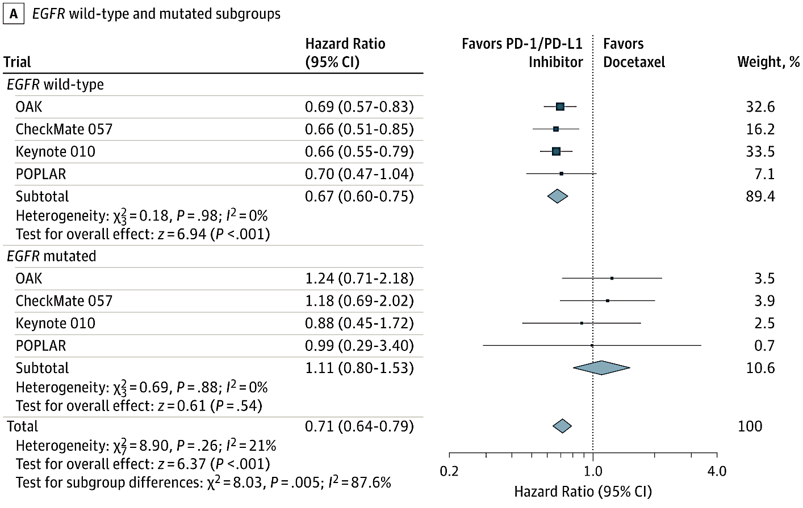
Poor Immunotherapy Response in EGFR-Mutated NSCLC
Overall survival hazard ratios
Mechanisms
Low tumor mutational burden
Immunosuppressive tumor microenvironment
Disrupted helper T-cell signaling
EGFR-mediated suppression of IFN-𝛄
TGF-β upregulation
Content courtesy of Jonathan Goldman, MD
Lee et al. JAMA Oncology 2018. Yang et al. J Clin Oncol 2024. Mok et al. J Clin Oncol 2024. Lu et al. Lancet Oncol 2022 and Lancet Respir Med 2023. Shi et al. Cancer Medicine 2021.

Slide 39
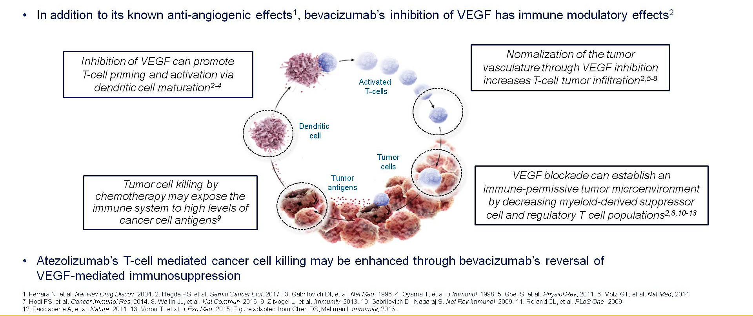
Rationale for the Combination of Atezolizumab + Bevacizumab + Chemotherapy
Content courtesy of Jonathan Goldman, MD
Socinski M et al. ASCO 2018.

Slide 40
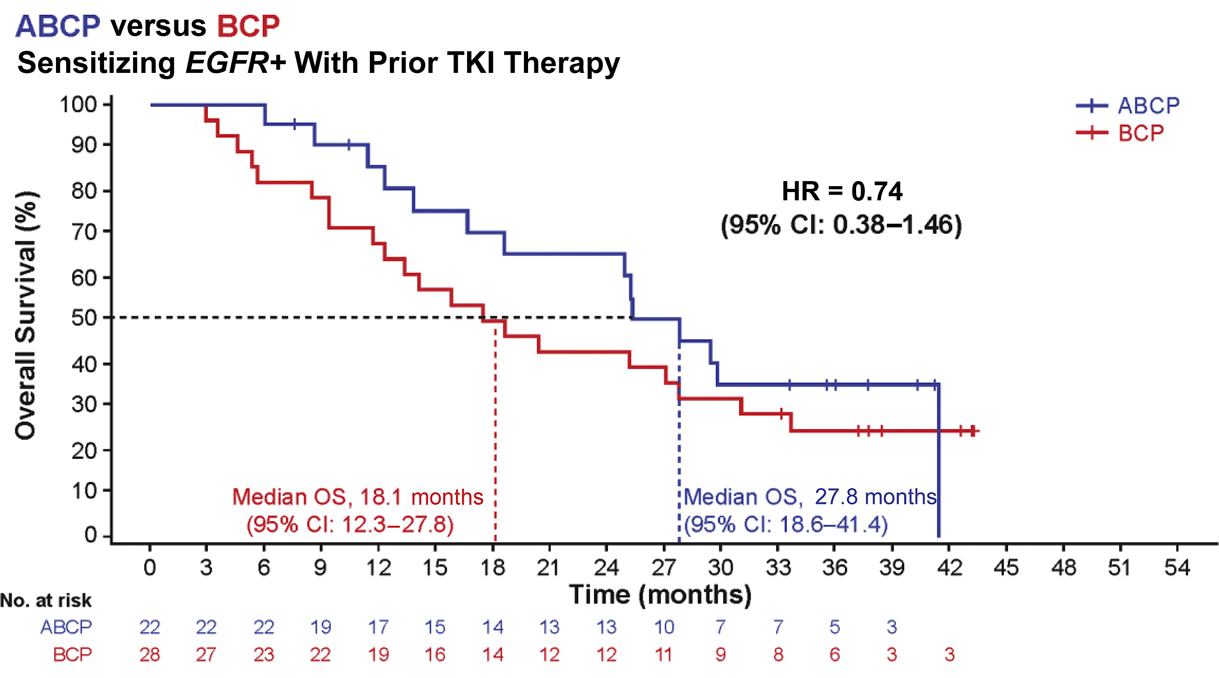
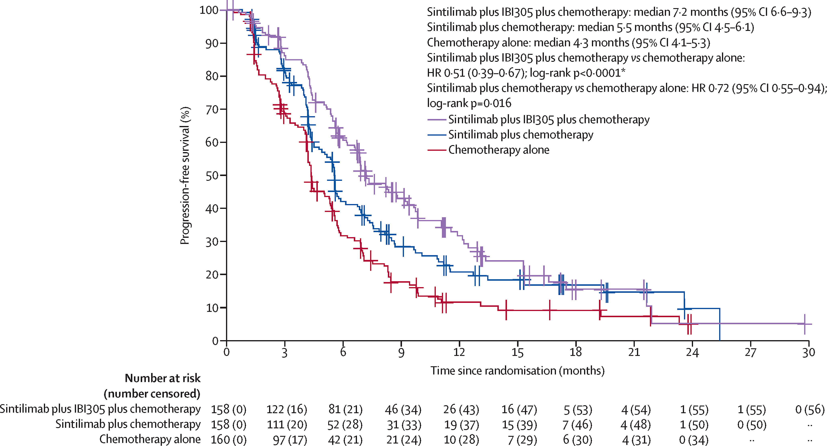
Combination Chemotherapy with VEGF Inhibition and Immunotherapy (IO)
IMpower150 trial: Chemo + VEGFi vs chemo + VEGFi + IO
Exploratory analysis in 123 patients with EGFRm.
  For all pt, OS HR 0.60.
  For those treated with previous TKI, HR 0.74.
ORIENT-31 trial: Chemo vs chemo + IO vs chemo + VEGFi + IO
PFS 4.3 vs 5.5 vs 7.2 months.
OS curves are overlapping.
Content courtesy of Jonathan Goldman, MD
Socinski et al. New Eng J Med 2018. Reck et al. Lancet Respir Med 2019 and Nogami et al. J Thor Oncol 2022. Lu et al. Lancet Respir Med 2023.

Slide 41
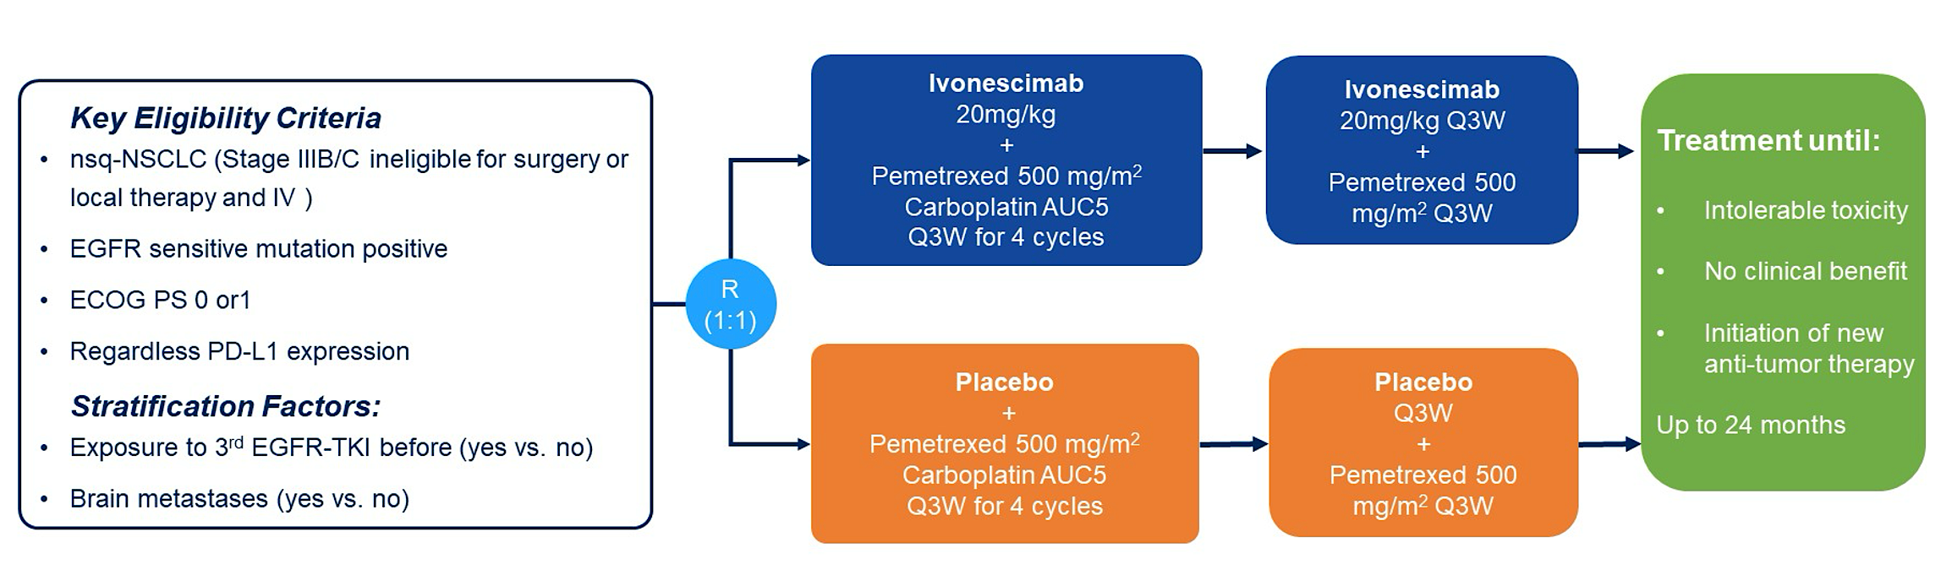
HARMONi-A Chinese Phase III Study Design
ECOG PS 0 or 1
Zhang L et al. ASCO 2024;Abstract 8508.

Slide 42
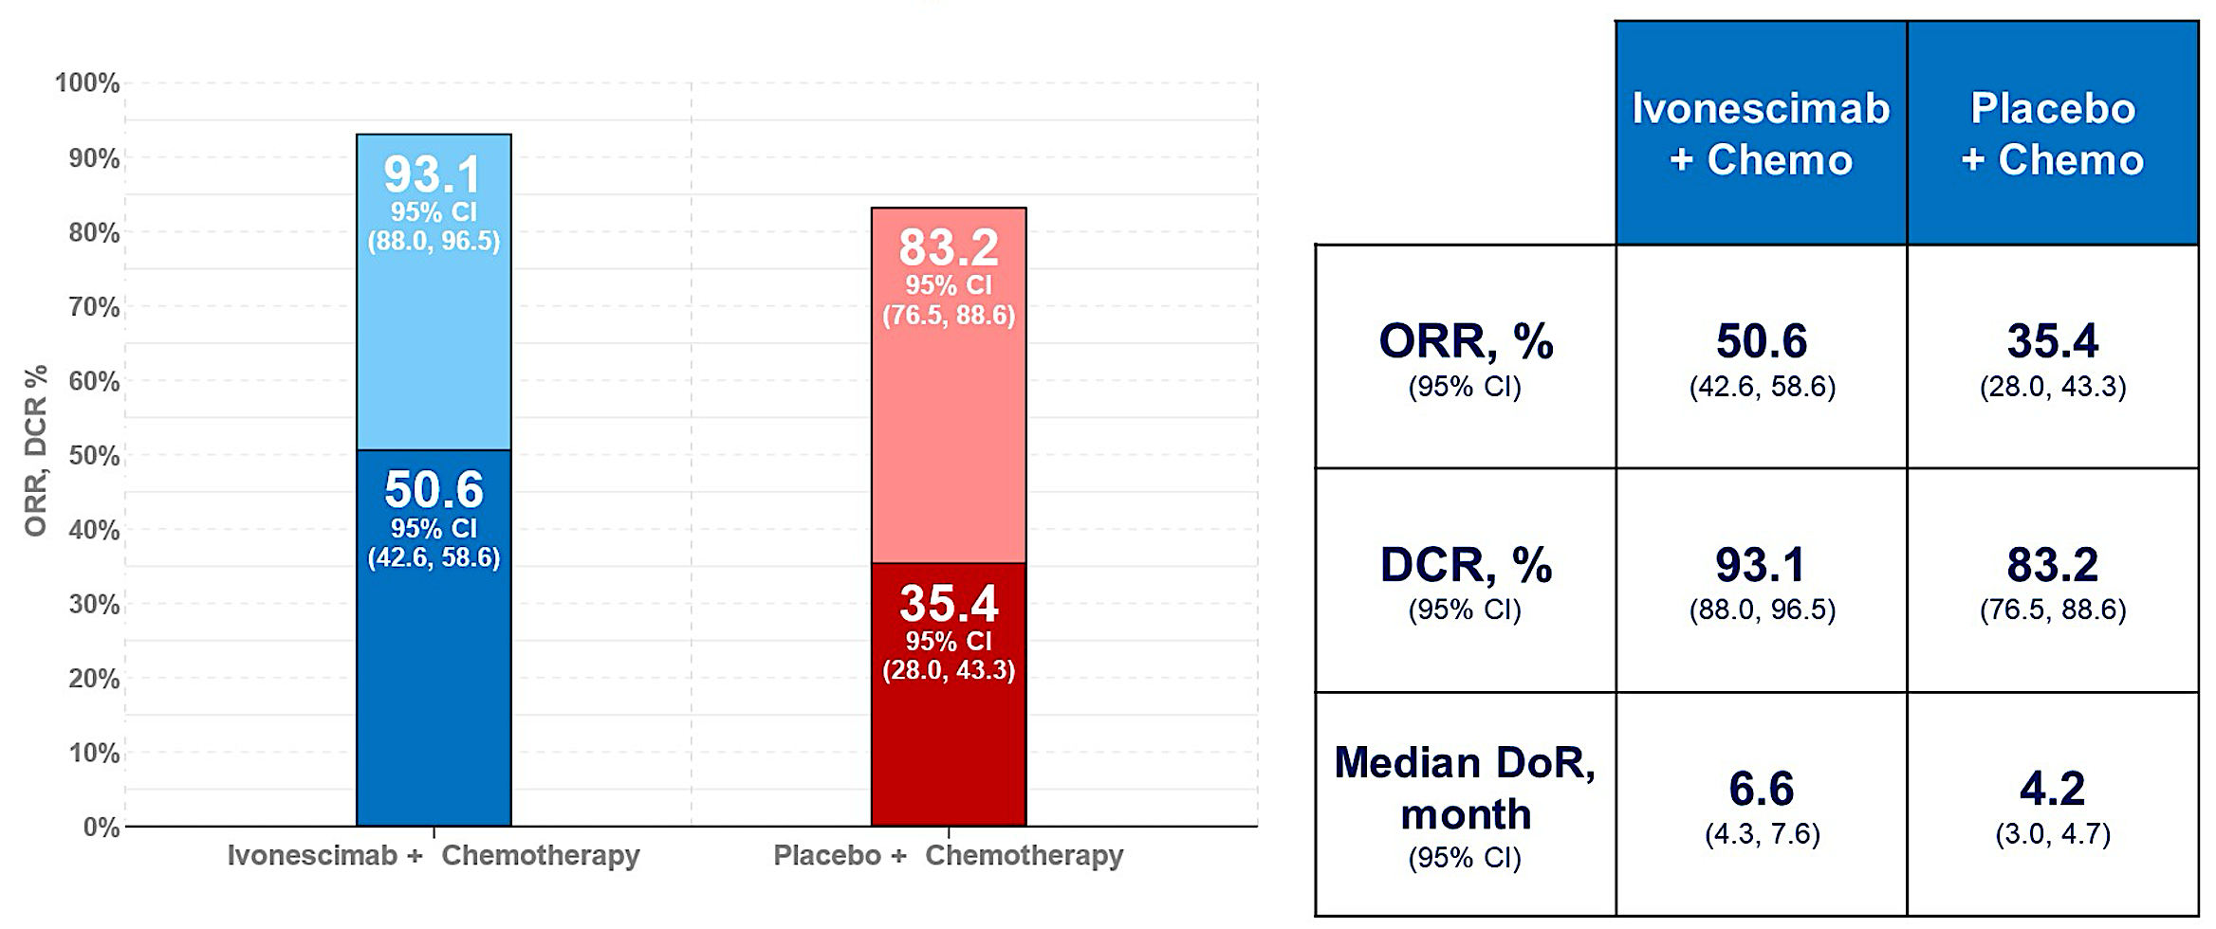
HARMONi-A: Response Data
ORR = objective response rate; DCR = disease control rate; DoR = duration of response
Zhang L et al. ASCO 2024;Abstract 8508.

Slide 43
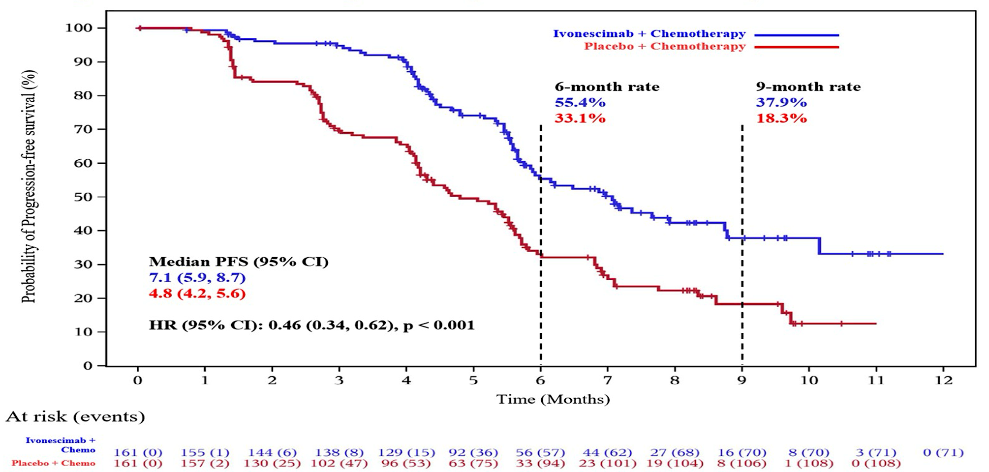
HARMONi-A: PFS Outcomes
Zhang L et al. ASCO 2024;Abstract 8508.

Slide 44
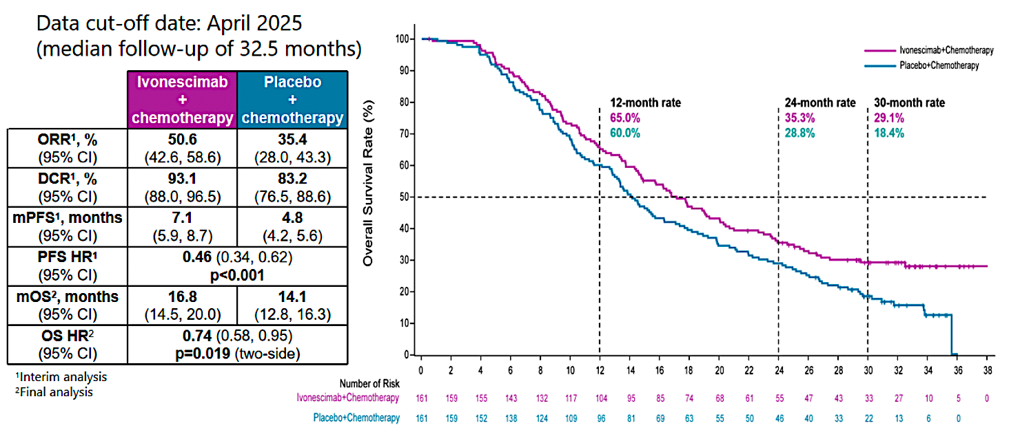
HARMONi-A: Final OS Analysis
Zhang L et al. SITC 2025;Abstract 1348.

Slide 45
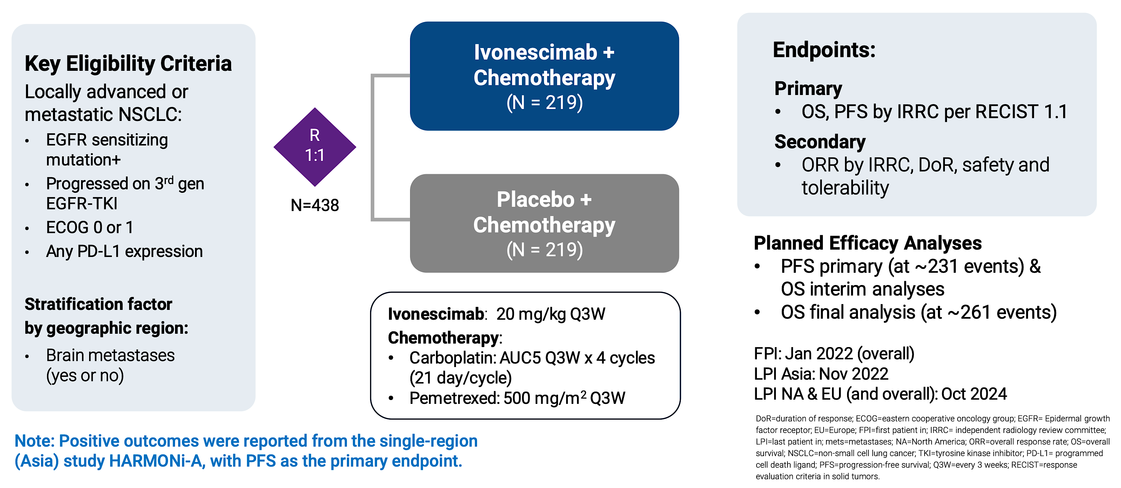
HARMONi Study Design (Asia and Western Populations)
Goldman J et al. WCLC 2025;Abstract PL02.12.

Slide 46
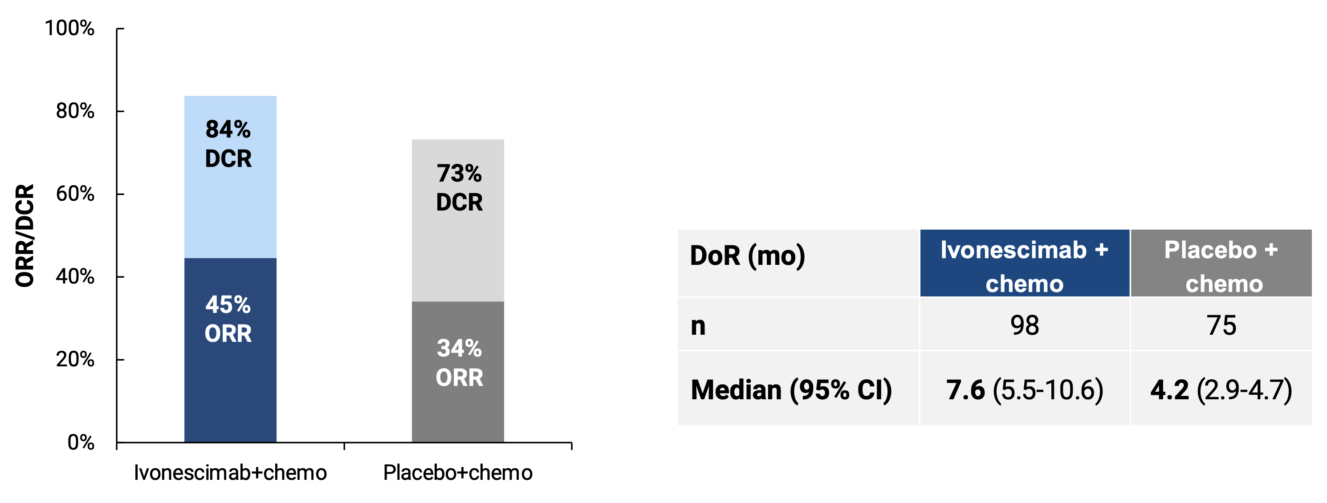
HARMONi: Response Data
ORR = overall response rate
Goldman J et al. WCLC 2025;Abstract PL02.12.

Slide 47
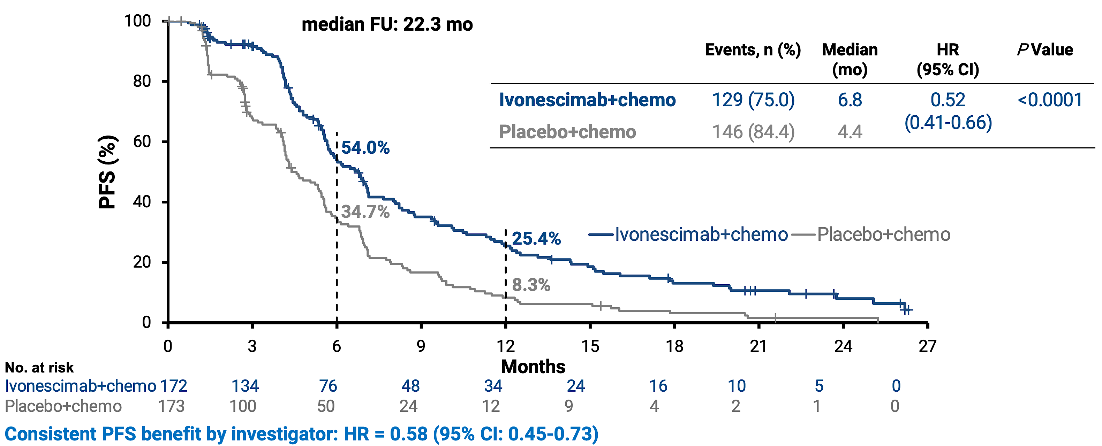
HARMONi: PFS Outcomes
Goldman J et al. WCLC 2025;Abstract PL02.12.

Slide 48
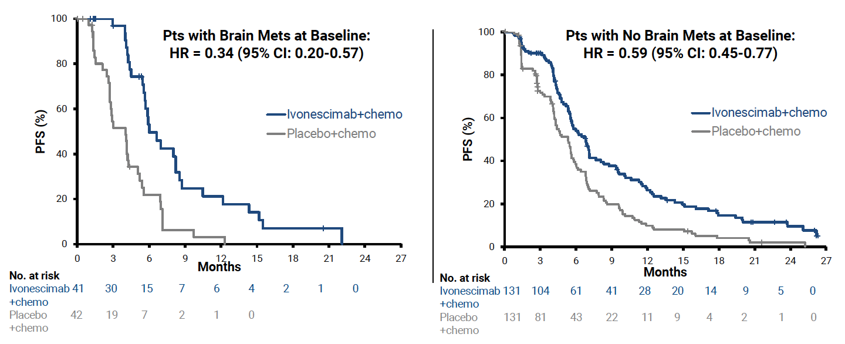
HARMONi: PFS by Brain Metastases Status
Goldman J et al. WCLC 2025;Abstract PL02.12.

Slide 49
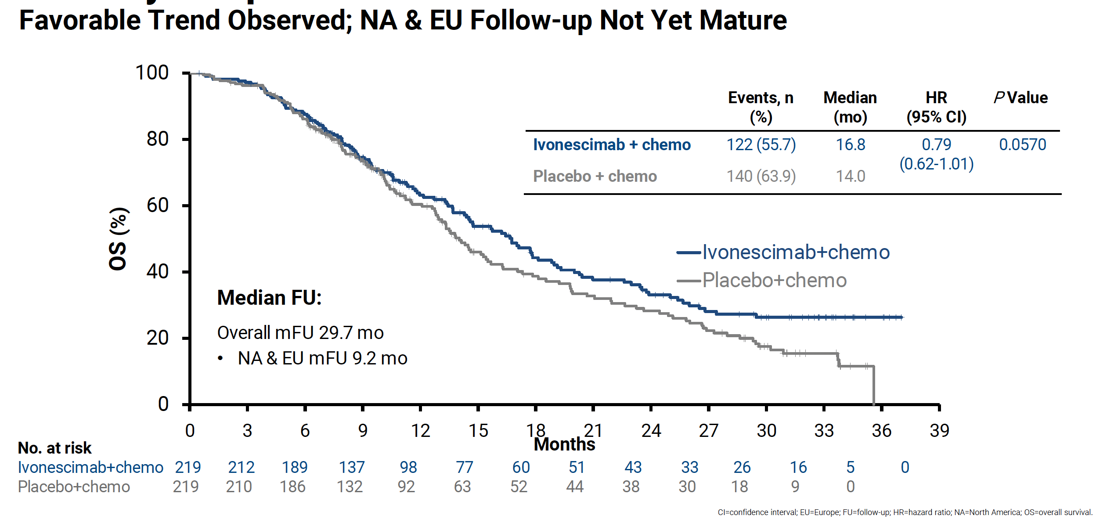
HARMONi: OS Outcomes
Goldman J et al. WCLC 2025;Abstract PL02.12.

Slide 50
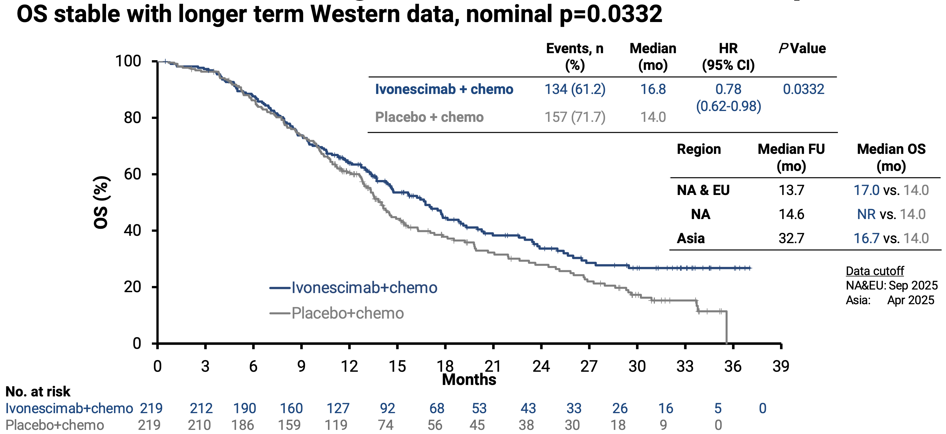
HARMONi: OS Outcomes
Goldman J et al. WCLC 2025;Abstract PL02.12.

Slide 51
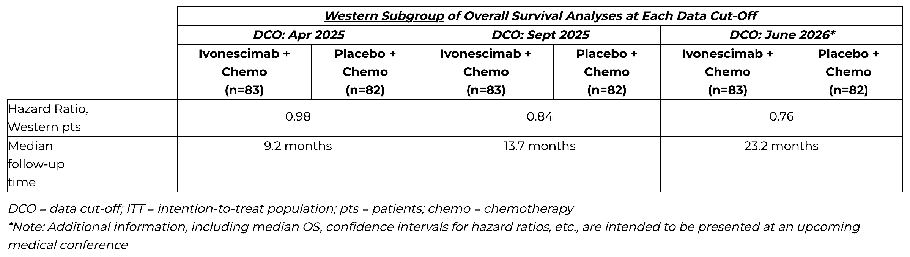
Ivonescimab with Chemotherapy Demonstrates Consistent, Favorable Overall Survival Results for Western and Asian Patients in an Updated Analysis from the Global Phase III HARMONi Study
Press Release: July 22, 2026
“[The manufacturer] announced results of an updated overall survival (OS) analysis from the global Phase III HARMONi clinical trial featuring ivonescimab. Ivonescimab plus platinum-doublet chemotherapy in this trial continues to show a positive OS trend and a consistent efficacy and safety profile in Asian and western patients when compared to chemotherapy alone.
*Note: Additional information, including median OS, confidence intervals for hazard ratios, etc., are intended to be presented at an upcoming medical conference”
https://smmttx.com/news/press-releases/news-details/2026/Ivonescimab-Plus-Chemotherapy-Shows-Consistent-Favorable-Overall-Survival-Results-in-Western-and-Asian-Patients-in-Updated-Analysis-from-Global-Phase-III-HARMONi-Study/default.aspx

Slide 52
FDA Acceptance of Biologics License Application Seeking Approval for Ivonescimab in Combination with Chemotherapy in the Treatment of EGFR-Mutated NSCLC After Tyrosine Kinase Inhibitor Therapy
Press Release: January 29, 2026
“The US Food & Drug Administration (FDA) has accepted for filing a Biologics License Application (BLA) seeking approval for ivonescimab in combination with chemotherapy in patients with epidermal growth factor receptor (EGFR)-mutated locally advanced or metastatic non-squamous non-small cell lung cancer (NSCLC) post-tyrosine kinase inhibitor (TKI) therapy.
The FDA provided a Prescription Drug User Fee Act (PDUFA) goal action date of November 14, 2026.
The BLA was submitted based on the overall results of the Phase III HARMONi trial, which evaluated ivonescimab plus platinum-doublet chemotherapy compared to placebo plus platinum-doublet chemotherapy in patients with EGFR-mutated, locally advanced or metastatic NSCLC who were previously treated with a 3rd generation EGFR TKI.”
https://smmttx.com/news/press-releases/news-details/2026/Summit-Therapeutics-Announces-U-S--FDA-Acceptance-of-Biologics-License-Application-BLA-Seeking-Approval-for-Ivonescimab-in-Combination-with-Chemotherapy-in-Treatment-of-Patients-with-EGFRm-NSCLC-Post-TKI-Therapy/default.aspx

Slide 53
Do you believe VEGF inhibition yields enhanced antitumor activity in EGFR-mutant NSCLC relative to EGFR wild-type disease?
Yes
Yes
Yes
I’m not sure
Yes
No
Yes

Slide 54
Do you believe the risk-benefit ratio with ivonescimab/chemotherapy in previously treated EGFR-mutated NSCLC supports its clinical use?
Yes, for select patients for whom chemotherapy makes sense
Yes
I’m not sure
Yes
I’m not sure
Yes
Yes

Slide 55
Would you like to be able to access ivonescimab/chemotherapy today for your patients with previously treated EGFR-mutated NSCLC?
No
Yes
I’m not sure
Yes
Yes
Yes
Yes

Slide 56
In what line of therapy do you envision ivonescimab/chemotherapy will be employed for patients with EGFR-mutated NSCLC?
Third line or later
Second line and beyond, but most likely in third line
Probably around fourth line
Second-line setting
Possibly in second line for patients with a smoking history,
higher PD-L1 status and limited benefit from EGFR TKIs
Second-line platinum doublet competing with COMPEL and MARIPOSA-2
Second line with platinum doublet after 3rd-generation EGFR TKI;
third line for patients who receive a TROP2-targeted ADC first
ADC = antibody-drug conjugate

Slide 57
Agenda
Module 1: Ivonescimab for Previously Untreated Metastatic Non-Small Cell Lung Cancer (mNSCLC)
Module 2: Ivonescimab for Relapsed/Refractory EGFR-Mutated mNSCLC
Module 3: Other Novel PD-1/PD-L1 x VEGF Bispecific Antibodies Under Investigation

Slide 58
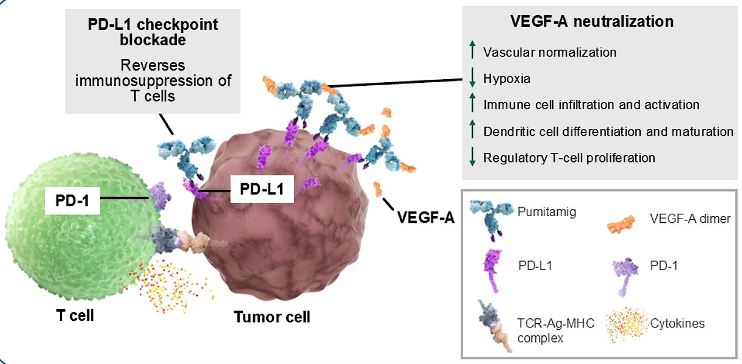
Pumitamig Mechanism of Action
Peters S et al. ASCO 2026;Abstract 8513.

Slide 59
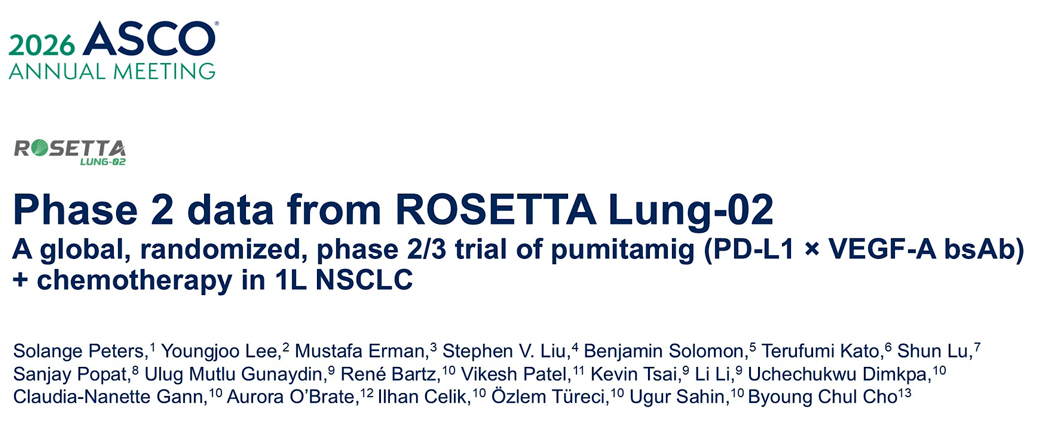
Abstract 8513

Slide 60
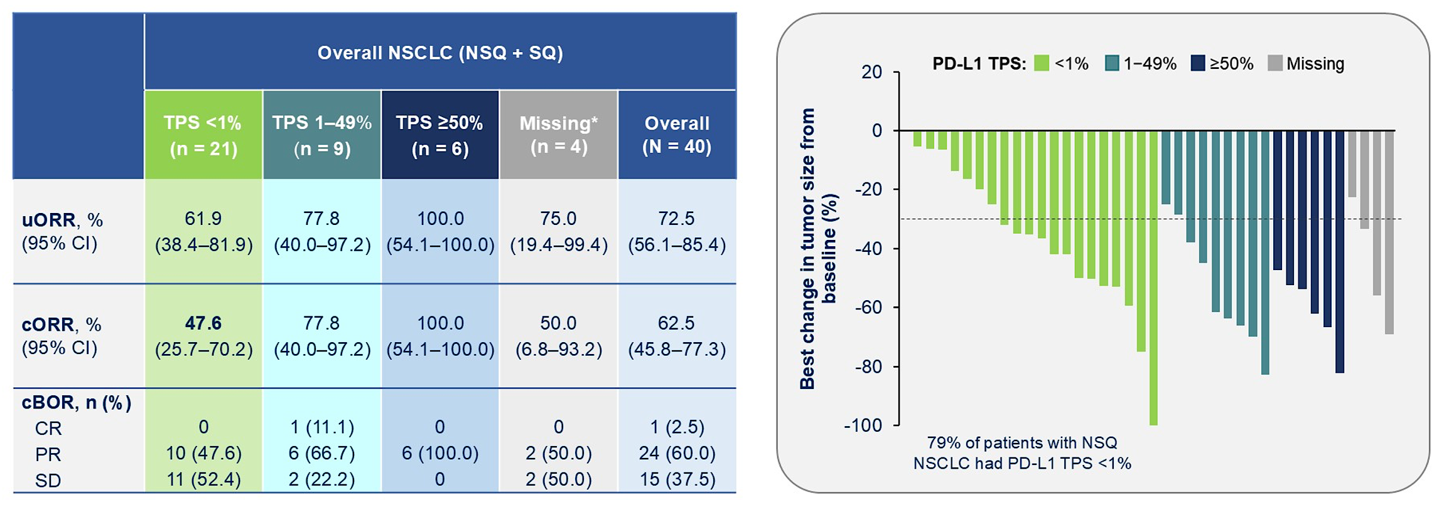
ROSETTA Lung-02: Response Data
Peters S et al. ASCO 2026;Abstract 8513.

Slide 61
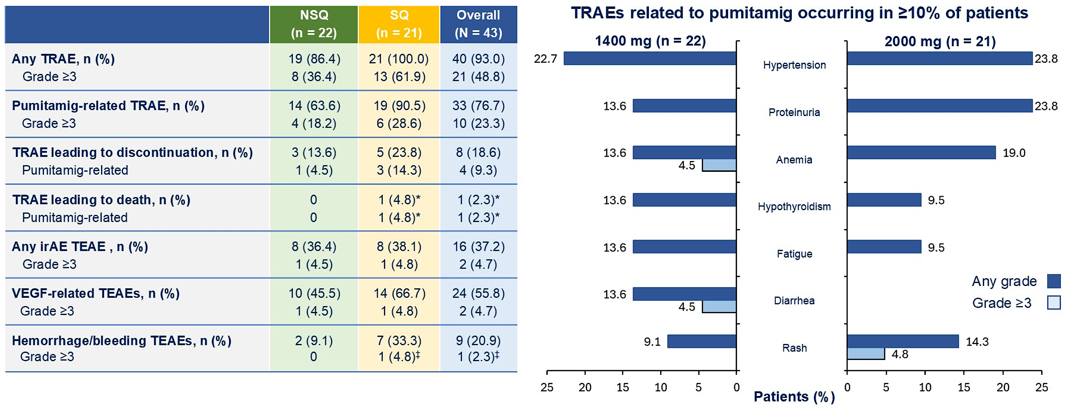
ROSETTA Lung-02: Safety Summary
Peters S et al. ASCO 2026;Abstract 8513.

Slide 62
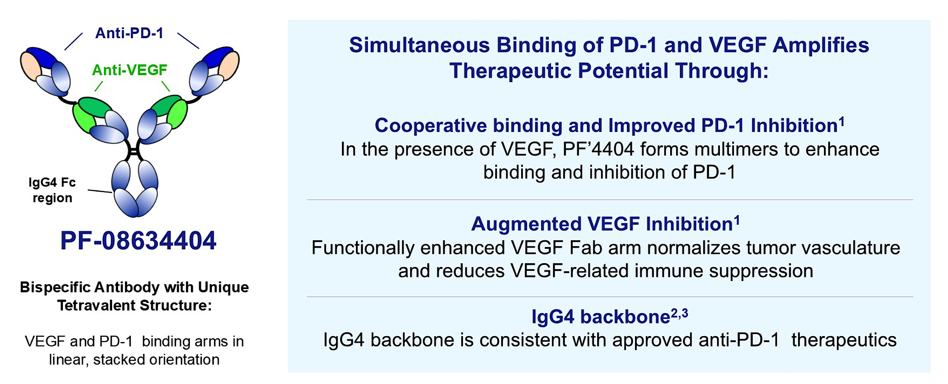
SSGJ-707 (PF-08634404) Mechanism of Action
Wu L et al. ASCO 2026;Abstract 8514.

Slide 63
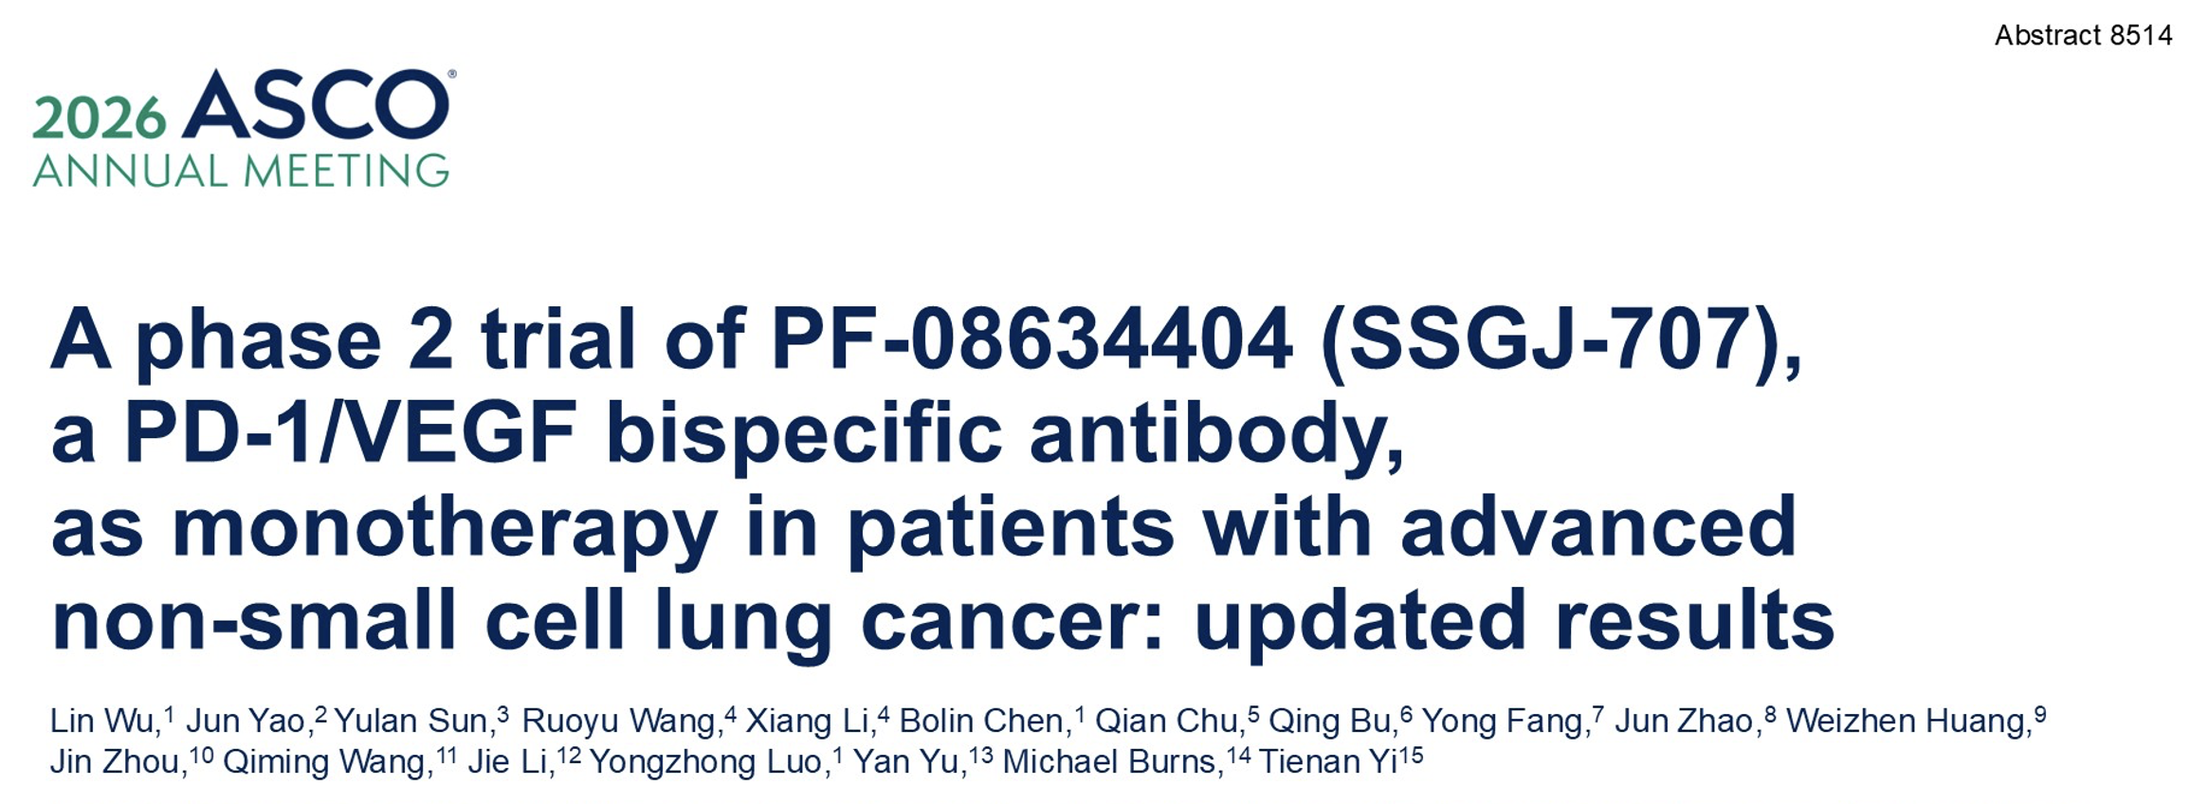

Slide 64
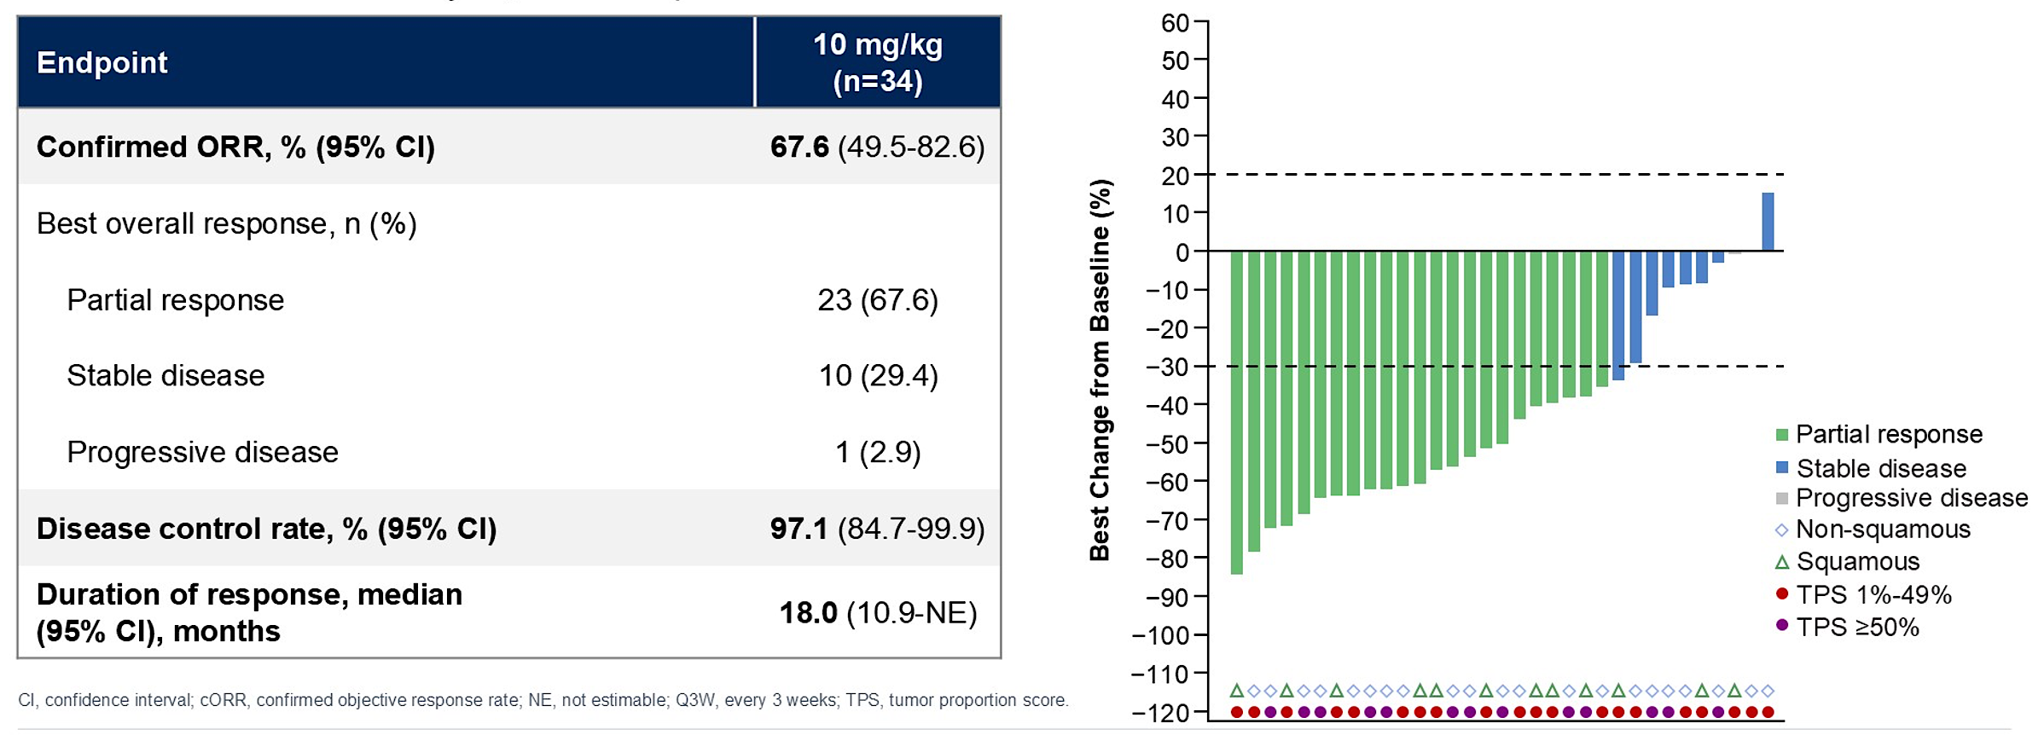
A Phase II Study of SSGJ-707 (PF-08634404) Monotherapy for PD-L1-Positive mNSCLC – Response Data
Wu L et al. ASCO 2026;Abstract 8514.

Slide 65
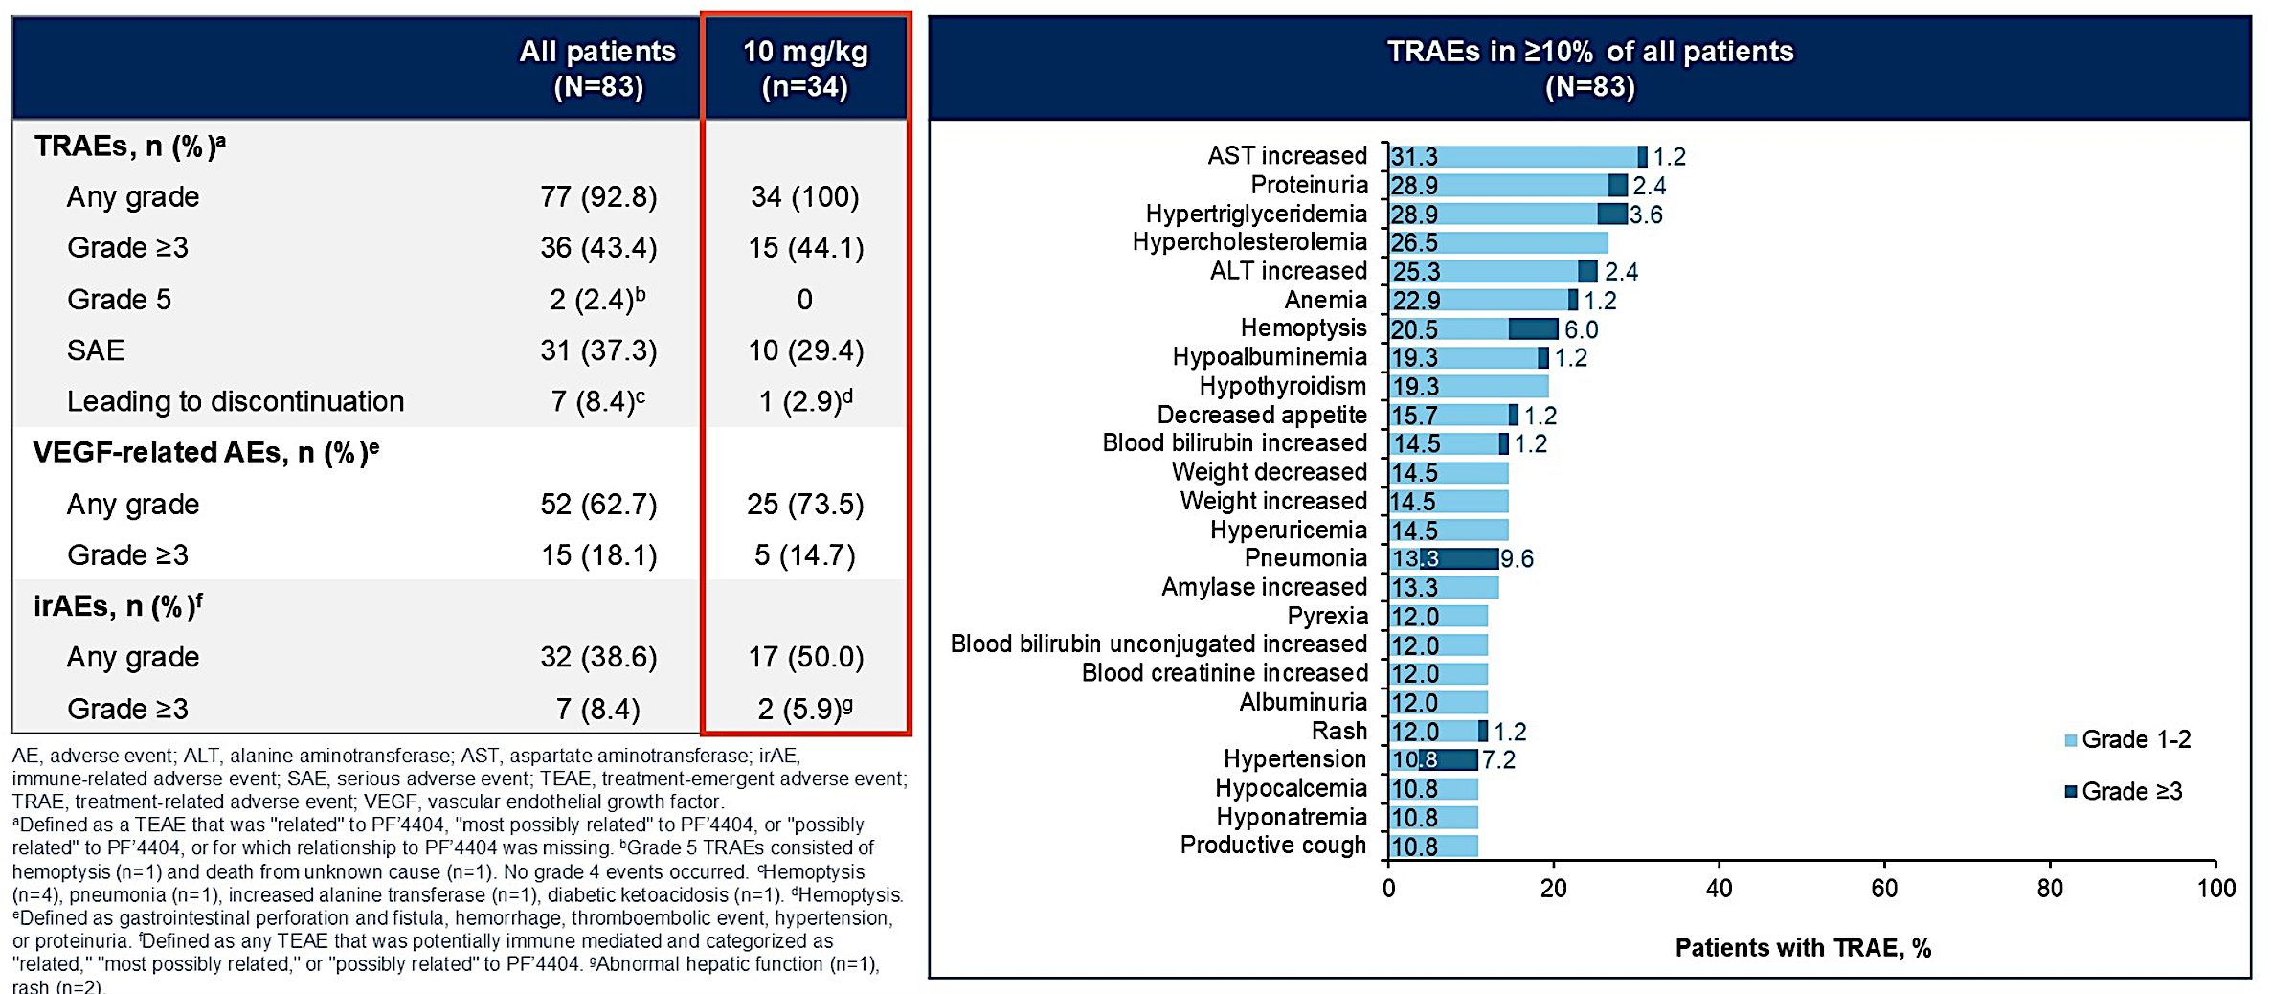
A Phase II Study of SSGJ-707 (PF-08634404) Monotherapy for PD-L1-Positive mNSCLC – Safety Summary
Wu L et al. ASCO 2026;Abstract 8514.

Slide 66
Thank you for your attention!
Questions?

Slide 67

Access CME credit form and download slides

