Slide 1
Second Opinion: Optimal Management of Localized Renal Cell Carcinoma
Part 1 of a 2-Part CME Satellite Symposium Series Held in Conjunction with
the 2026 American Urological Association Annual Meeting (AUA2026)
Sunday, May 17, 2026
8:00 AM – 9:30 AM ET
Faculty
Eric A Singer, MD, MA, MS, FACS, FASCO
Ulka Vaishampayan, MD
Moderator
Thomas E Hutson, DO, PharmD, PhD

Slide 2



Faculty
Eric A Singer, MD, MA, MS, FACS, FASCO
The Dave Longaberger Endowed Chair in Urology
Professor of Urology and Bioethics
Chief, Division of Urologic Oncology
Director, Urologic Oncology Fellowship
The Ohio State University Comprehensive Cancer Center
Columbus, Ohio
Moderator
Thomas E Hutson, DO, PharmD, PhD
Medical Oncology — Clinical Research Drug Development
Texas Oncology
GU Executive and Bridge Committees
Sarah Cannon Research Institute (SCRI)
Abilene, Texas
Ulka Vaishampayan, MD
Beverly Mitchell Research Professor of Oncology
Co-Leader of Translational Clinical Research Program
University of Michigan/Rogel Cancer Center
Ann Arbor, Michigan

Slide 3
Dr Singer — Disclosures
Faculty
No relevant financial relationships to disclose.

Slide 4
Dr Vaishampayan — Disclosures
Faculty
Advisory Committees | AstraZeneca Pharmaceuticals LP, Aveo Pharmaceuticals, Pfizer Inc
Consulting Agreements | Bayer HealthCare Pharmaceuticals, Bristol Myers Squibb, Exelixis Inc, Janssen Biotech Inc, Kowa Pharmaceuticals America, Merck, Novartis
Contracted Research | Merck
Nonrelevant Financial Relationships | SWOG

Slide 5
Dr Hutson — Disclosures
Moderator
No relevant financial relationships to disclose.

Slide 6
Dr Armstrong — Disclosures
Consulting Faculty
Advisory Committees | Astellas, AstraZeneca Pharmaceuticals LP, Bayer HealthCare Pharmaceuticals, Bristol Myers Squibb, Merck, Pfizer Inc, Precede Biosciences, Sumitomo Pharma America, Telix Pharmaceuticals Limited
Consulting Agreements | Amgen Inc, Astellas, Bayer HealthCare Pharmaceuticals, Janssen Biotech Inc, Novartis, Pfizer Inc
Contracted Research | Amgen Inc, Astellas, AstraZeneca Pharmaceuticals LP, Bayer HealthCare Pharmaceuticals, Bristol Myers Squibb, FibroGen Inc, Janssen Biotech Inc, Merck, Novartis, Pathos, Pfizer Inc

Slide 7
Dr McKay — Disclosures
Consulting Faculty
Advisory Committees and Consulting Agreements | Ambrx, Arcus Biosciences, AstraZeneca Pharmaceuticals LP, Aveo Pharmaceuticals, Bayer HealthCare Pharmaceuticals, Blue Earth Diagnostics, Boundless Bio, Bristol Myers Squibb, Calithera Biosciences, Caris Life Sciences, Daiichi Sankyo Inc, Dendreon Pharmaceuticals Inc, Eisai Inc, Exelixis Inc, Janssen Biotech Inc, Lilly, Merck, Myovant Sciences, Neomorph, Nimbus Therapeutics, Novartis, Pfizer Inc, Sanofi, Seagen Inc, Sorrento Therapeutics, Telix Pharmaceuticals Limited, Tempus
Contracted Research | Artera, AstraZeneca Pharmaceuticals LP, Bristol Myers Squibb, Exelixis Inc, Incyte Corporation, Natera Inc, Oncternal Therapeutics

Slide 8
Dr Motzer — Disclosures
Consulting Faculty
Contracted Research | Bristol Myers Squibb, Eisai Inc, Exelixis Inc, Merck

Slide 9
Dr Srinivas — Disclosures
Consulting Faculty
Advisory Committees | Janssen Biotech Inc, Merck
Contracted Research | Bristol Myers Squibb, Merck, Pfizer Inc, Regeneron Pharmaceuticals Inc
Data and Safety Monitoring Boards/Committees | Johnson & Johnson

Slide 10
Commercial Support
This activity is supported by an educational grant from Merck.
Research To Practice CME Planning Committee Members,
Staff and Reviewers
Planners, scientific staff and independent reviewers for Research To Practice have no relevant financial relationships to disclose.

Slide 11
This educational activity contains discussion of
non-FDA-approved uses of agents and regimens. Please refer to official prescribing information for each product for approved indications.

Slide 12



Clinicians in the Meeting Room
Networked iPads are available.
Review Program Slides: Tap the Program Slides button to review speaker presentations and other program content.
Answer Survey Questions: Complete the pre- and postmeeting surveys. Survey questions will be discussed throughout the meeting.
Ask a Question: Tap Ask a Question to submit a challenging case or question for discussion. We will aim to address as many questions as possible during the program.
For assistance, please raise your hand. Devices will be collected at the conclusion of the activity.
Notes:
12

Slide 13

Clinicians Attending via Zoom
Review Program Slides: A link to the program slides will be posted in the chat room at the start of the program.
Answer Survey Questions: Complete the pre- and postmeeting surveys.
Ask a Question: Submit a challenging case or question for discussion using the Zoom chat room.
Get CME Credit: A credit link will be provided in the chat room at the conclusion of the program.
Notes:
13

Slide 14
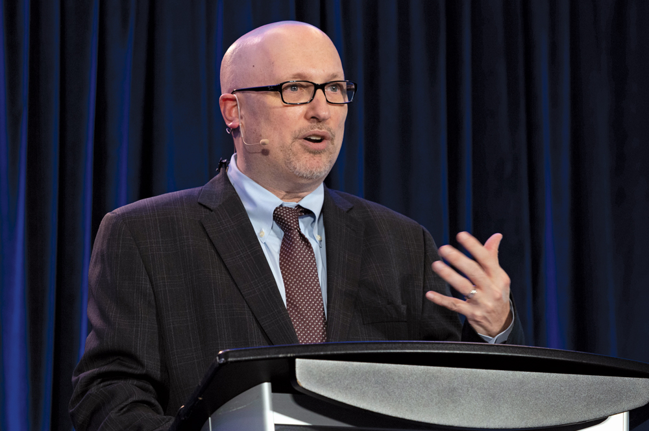
About the Enduring Program
The live meeting is being video
and audio recorded.
The proceedings from today will
be edited and developed into
an enduring web-based
program. An email will be sent to all
attendees when the activity is available.
To learn more about our education programs, visit our website, www.ResearchToPractice.com
Notes:
14
14

Slide 15
Second Opinion: Investigators Provide Perspectives on the Current and Future Management of Prostate Cancer
Part 2 of a 2-Part CME Satellite Symposium Series Held in Conjunction with
the 2026 American Urological Association Annual Meeting (AUA2026)
Sunday, May 17, 2026
5:30 PM – 7:30 PM ET
Faculty
Neeraj Agarwal, MD, FASCO
Daniel P Petrylak, MD
Fred Saad, CQ, MD
Neal D Shore, MD
Moderator
Elisabeth I Heath, MD

Slide 16
Second Opinion: Optimal Management of Localized Renal Cell Carcinoma
Part 1 of a 2-Part CME Satellite Symposium Series Held in Conjunction with
the 2026 American Urological Association Annual Meeting (AUA2026)
Sunday, May 17, 2026
8:00 AM – 9:30 AM ET
Faculty
Eric A Singer, MD, MA, MS, FACS, FASCO
Ulka Vaishampayan, MD
Moderator
Thomas E Hutson, DO, PharmD, PhD

Slide 17



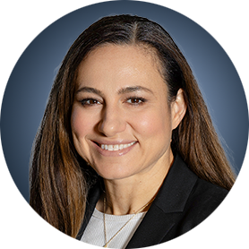
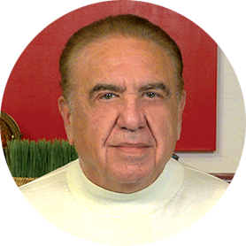
Second Opinion
Andrew J Armstrong, MD, ScM
Professor of Medicine, Urology, Pharmacology and Cancer Biology
Director of Research
Duke Cancer Institute Center for Prostate and Urologic Cancers
Division of Medical Oncology
Departments of Medicine and Urology
Duke University
Durham, North Carolina
Robert J Motzer, MD
Attending Physician, Department of Medicine
Jack and Dorothy Byrne Chair in Clinical Oncology
Memorial Sloan Kettering Cancer Center
New York, New York
Sandy Srinivas, MD
Professor of Oncology
Clinical Research Leader, GU Oncology
Stanford University
Stanford, California
Rana R McKay, MD, FASCO
Professor of Medicine, Urology, and Radiation Medicine and Applied Sciences
Associate Director, Clinical Research
Co-Lead, Genitourinary Program
Moores Cancer Center
University of California San Diego
San Diego, California
Neil Love, MD
Research To Practice
Miami, Florida

Slide 18
Agenda
Module 1: Current Indications for Adjuvant Immune Checkpoint Inhibitor Therapy in the Management of Renal Cell Carcinoma (RCC) — Dr Singer
Module 2: Potential Role of Hypoxia-Inducible Factor-2 Alpha (HIF-2α) Inhibitors as a Component of Adjuvant Treatment — Dr Hutson
Module 3: Tolerability of Current and Emerging Adjuvant Approaches for RCC — Dr Vaishampayan

Slide 19
Agenda
Module 1: Current Indications for Adjuvant Immune Checkpoint Inhibitor Therapy in the Management of Renal Cell Carcinoma (RCC) — Dr Singer
Module 2: Potential Role of Hypoxia-Inducible Factor-2 Alpha (HIF-2α) Inhibitors as a Component of Adjuvant Treatment — Dr Hutson
Module 3: Tolerability of Current and Emerging Adjuvant Approaches for RCC — Dr Vaishampayan

Slide 20


Indications for Adjuvant Immune Checkpoint Inhibitor Therapy in Renal Cell Carcinoma
Eric A. Singer, MD, MA, MS, FACS, FASCO
The Dave Longaberger Endowed Chair in Urology
Professor of Urology and Bioethics
Chief, Division of Urologic Oncology
Director, Urologic Oncology Fellowship
The Ohio State University Comprehensive Cancer Center

Slide 21
Learning Objectives
Review available RCC risk stratification schema
Discuss current indications for adjuvant immunotherapy
Consider future directions

Slide 22
Scope
NOT metastatic disease
NOT focused on biomarkers
NOT focused on active surveillance
NOT able to cover every stratification system/update

Slide 23
Why is Risk Stratification Needed?

Slide 24

Why is Risk Stratification Needed?
“Diagnostic elegance and therapeutic parsimony”

Slide 25
Why is Risk Stratification Needed?
“Diagnostic elegance and therapeutic parsimony”
Incidentally found
Symptomatic

Slide 26
Why is Risk Stratification Needed?
“Diagnostic elegance and therapeutic parsimony”
Surveillance
Biopsy
Ablation (thermal, histotripsy)
Radiation
Resection (partial vs. total)
Adjuvant therapy (IO, IO+HIF, trial)

Slide 27
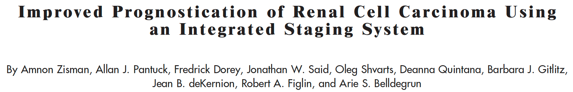
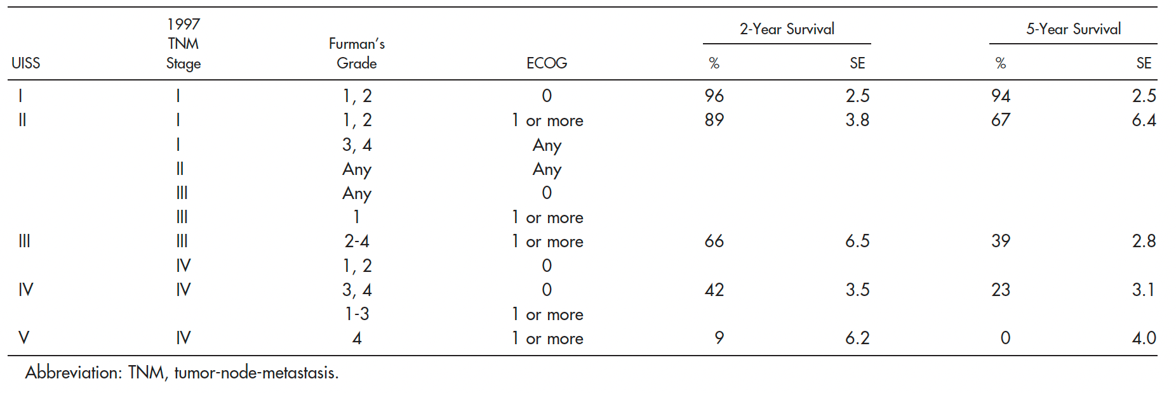

Slide 28
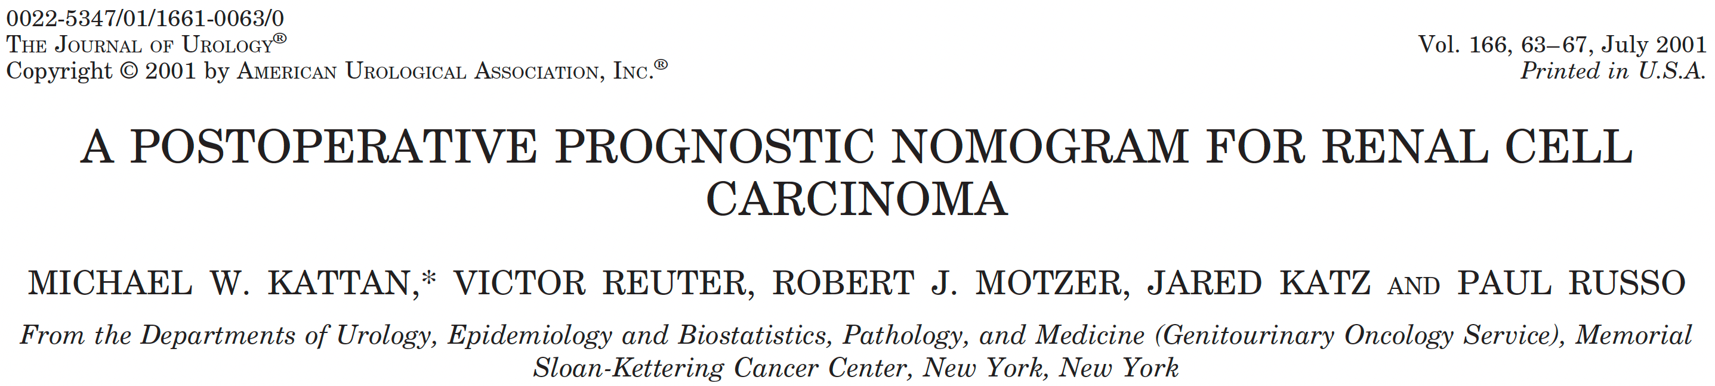
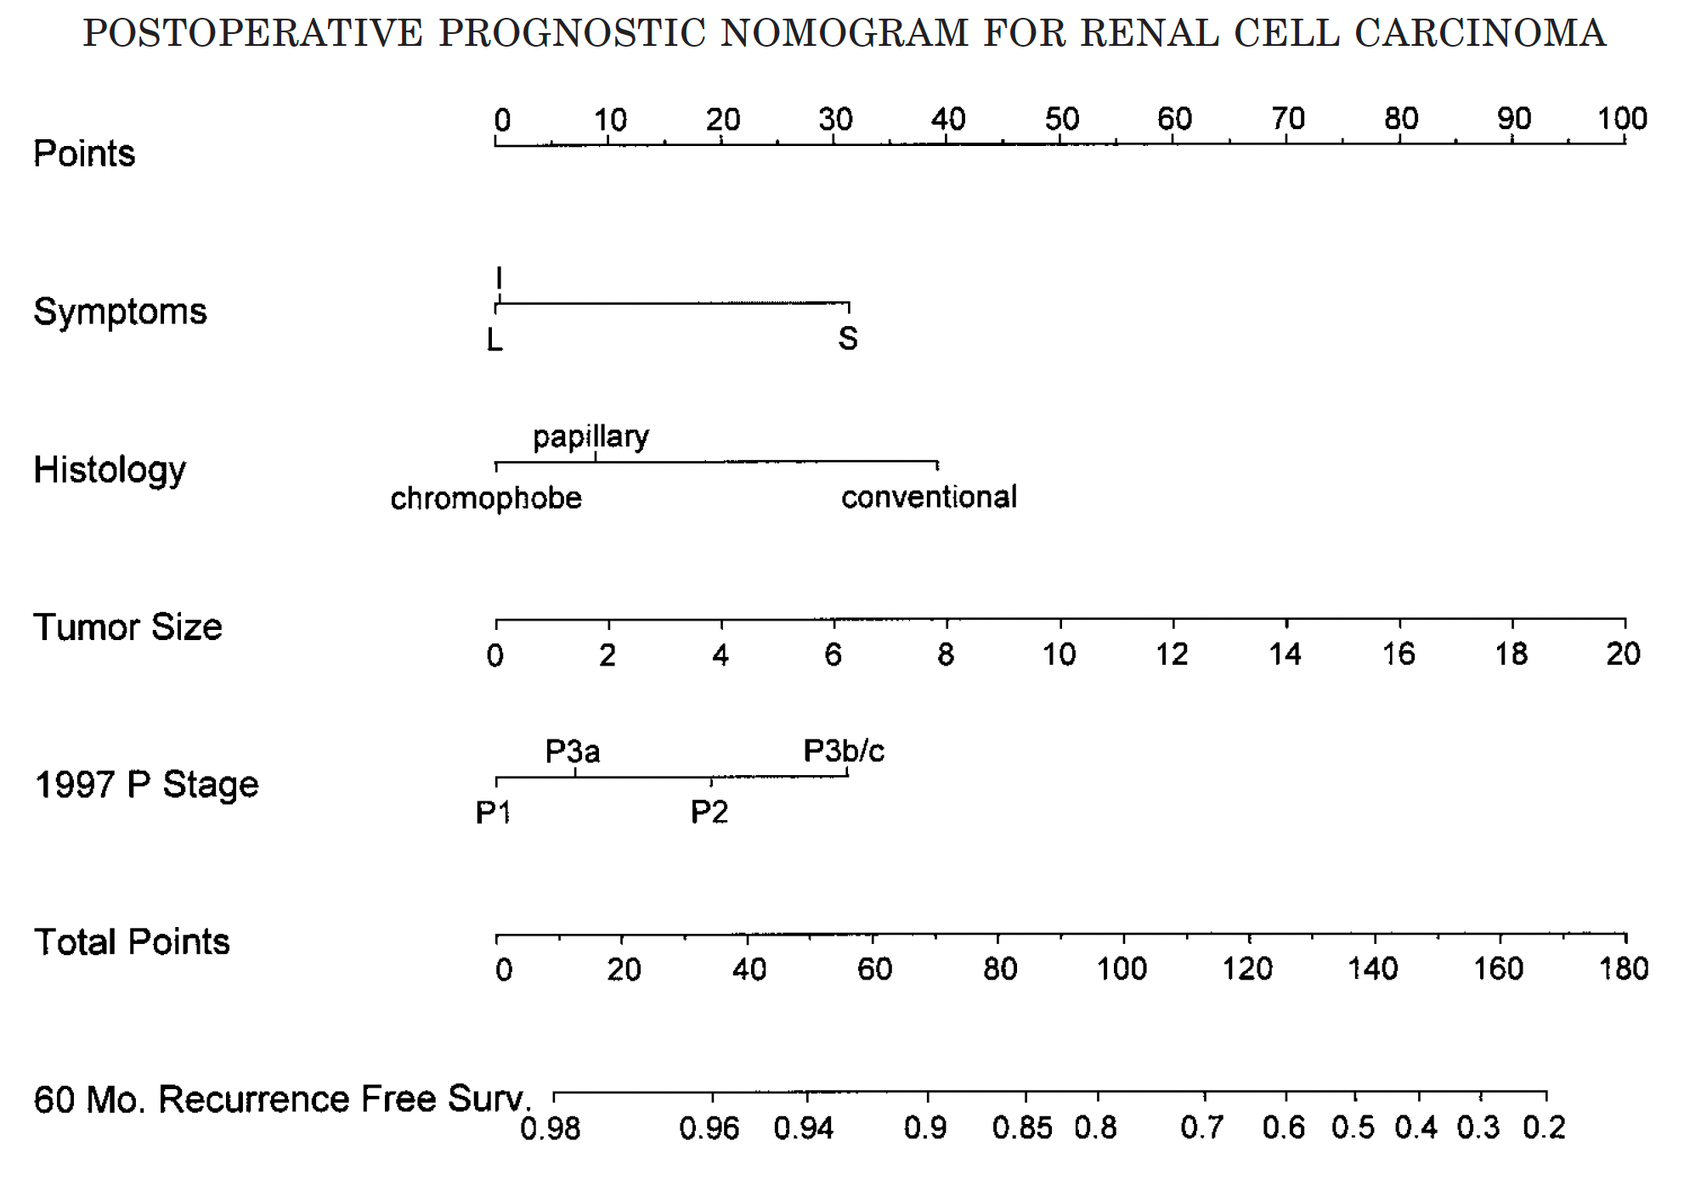
Incidental, Local, Systemic

Slide 29
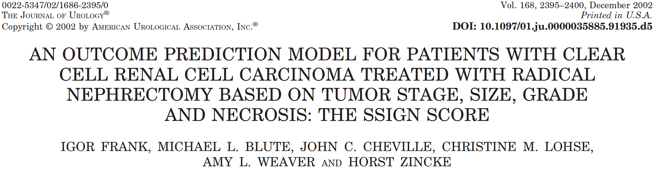
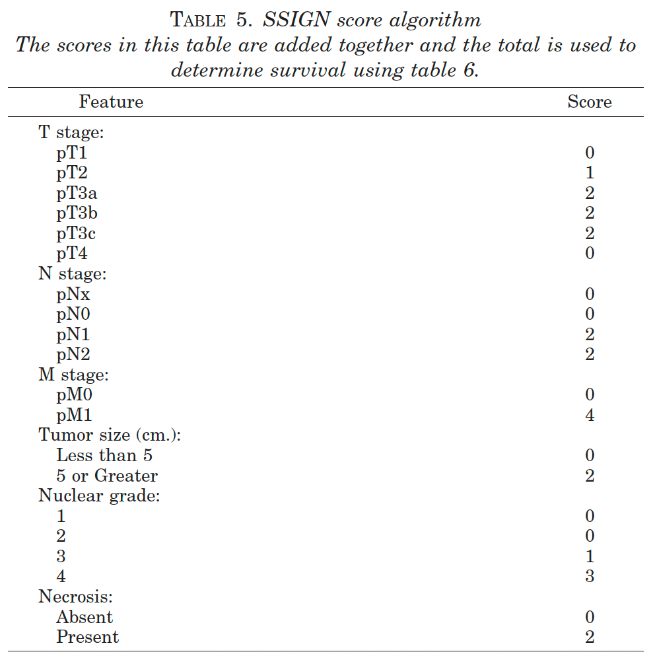
TNM
Size
Grade
Necrosis

Slide 30
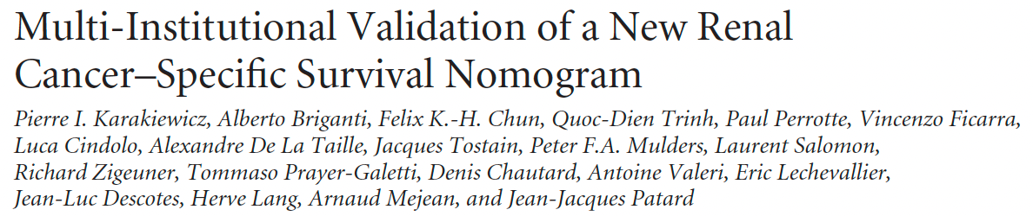
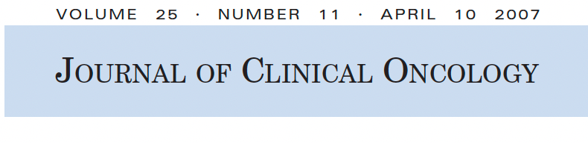
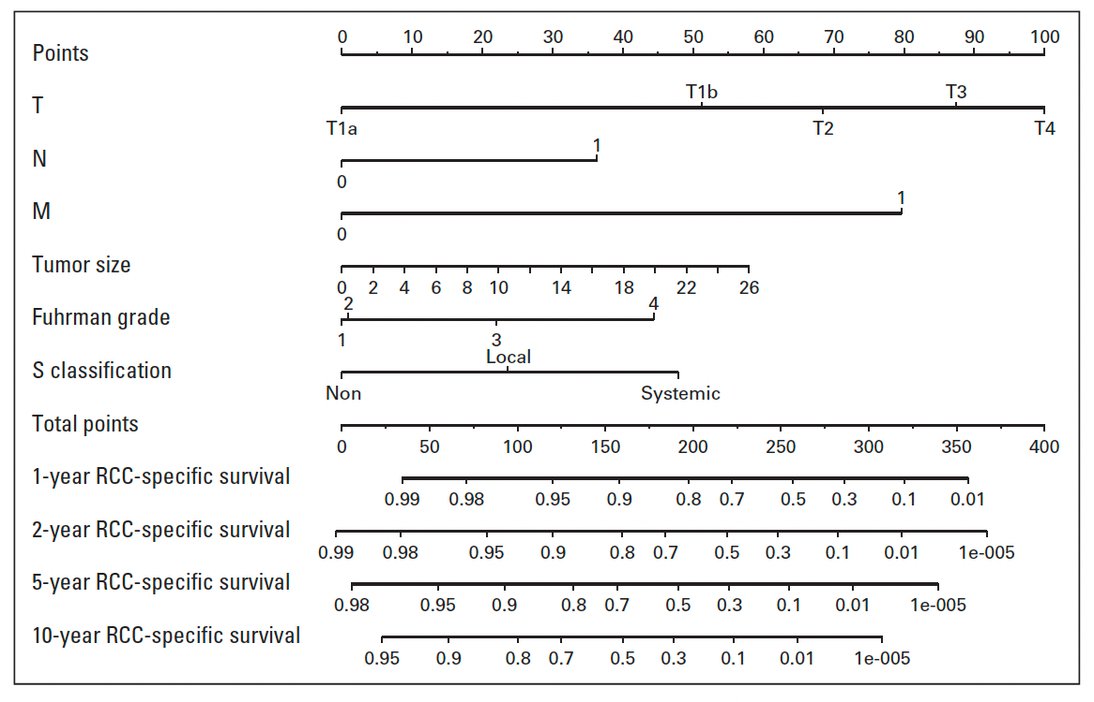

Slide 31
Larger test and validation sets
Improved prediction 2.5-5.4%
Longer predictive timespan
Readily obtained data elements (not necrosis)

Slide 32
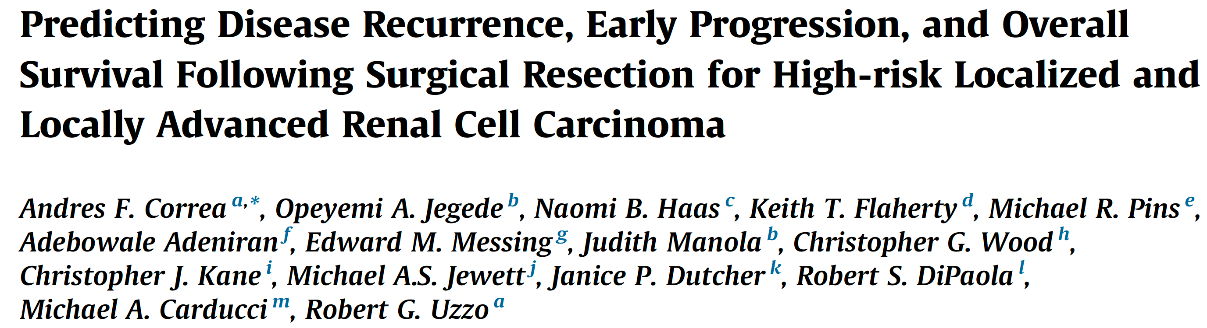

Slide 33
Study population consists of 1,735 patients recruited and followed in the ECOG-ACRIN 2805 (ASSURE) RCC trial
Adjuvant targeted therapy (sunitinib and sorafenib) in patients with fully resected intermediate- and high-risk localized kidney cancer
(pT1b and G3–4; pT2/pT3/pT4; N1)

Slide 34
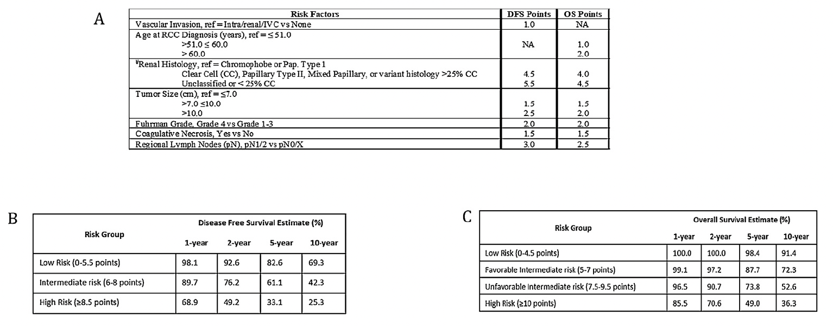

Slide 35

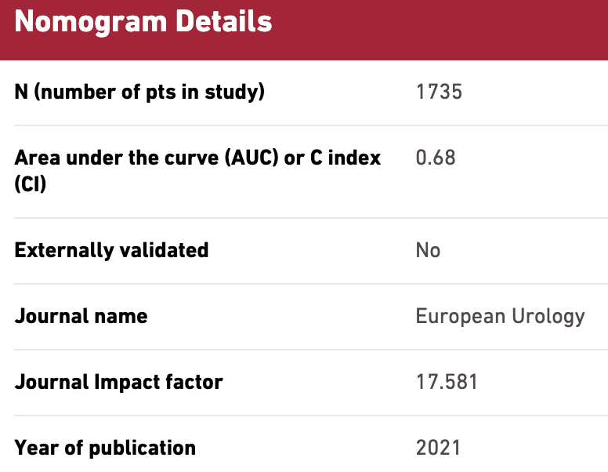

Slide 36
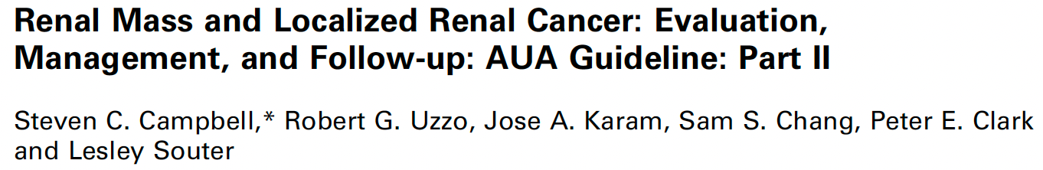
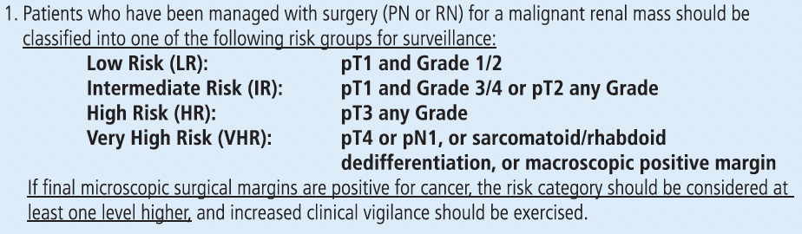

Slide 37
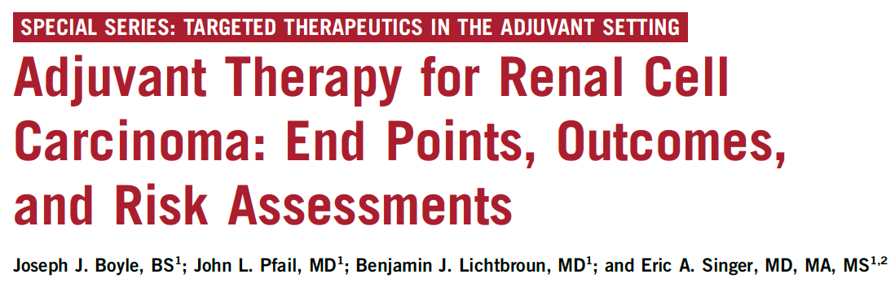

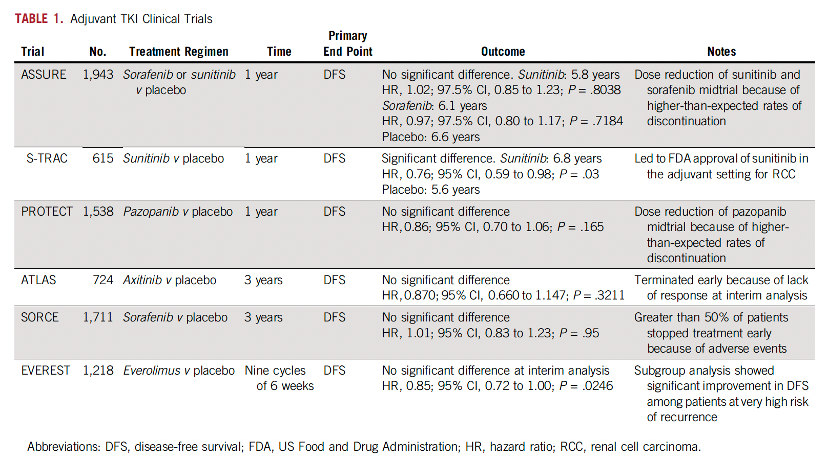

Slide 39
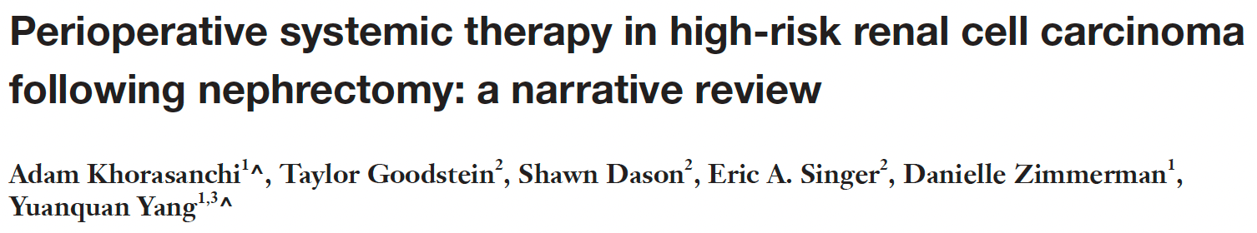

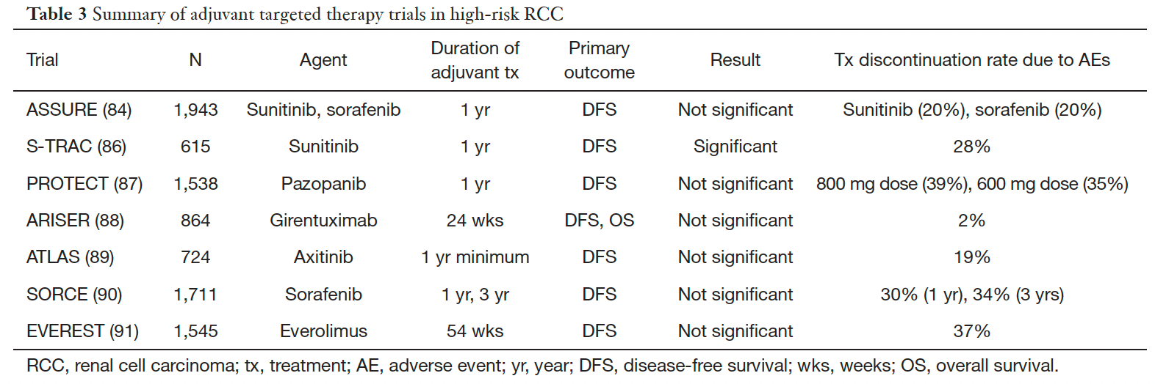

Slide 40
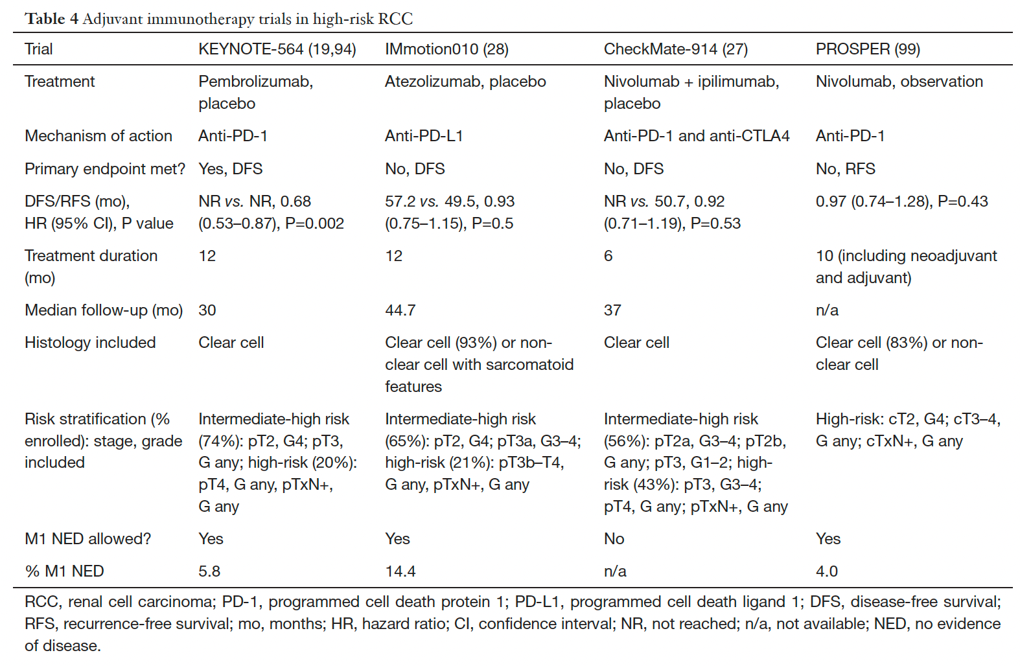

Slide 42
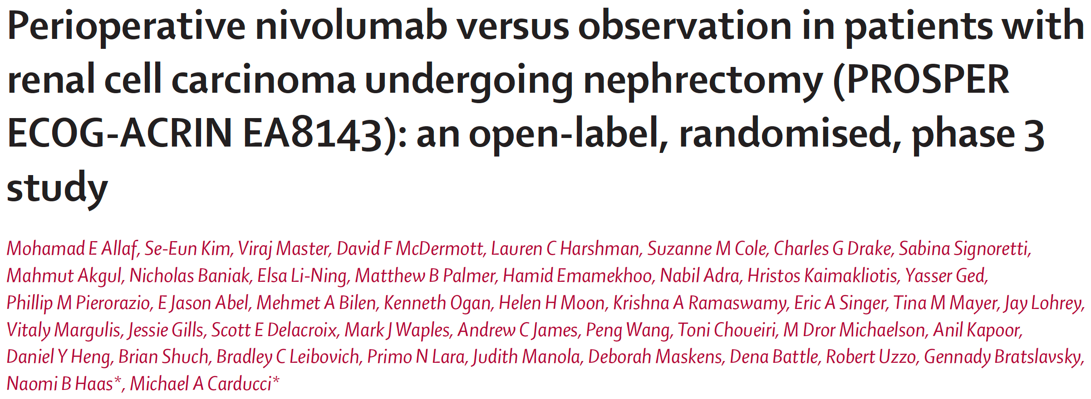

Slide 43
Clinical stage T2 or greater or T_{any} N+ renal cell carcinoma of clear cell or non-clear cell histology planned for partial or radical nephrectomy.
Selected patients with oligometastatic disease, who were disease free at other disease sites within 12 weeks of surgery, were eligible for inclusion.

Slide 44
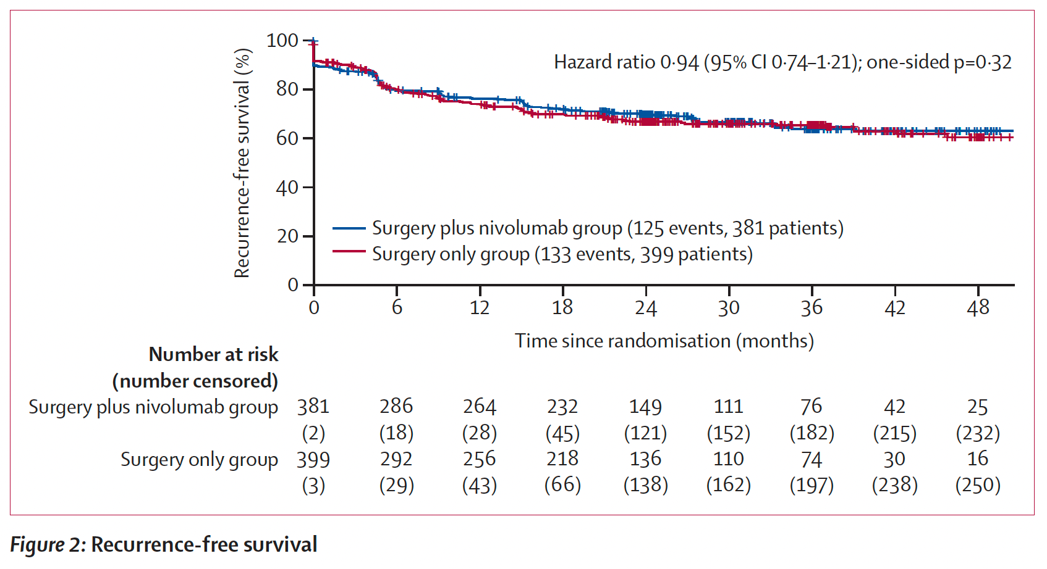

Slide 45
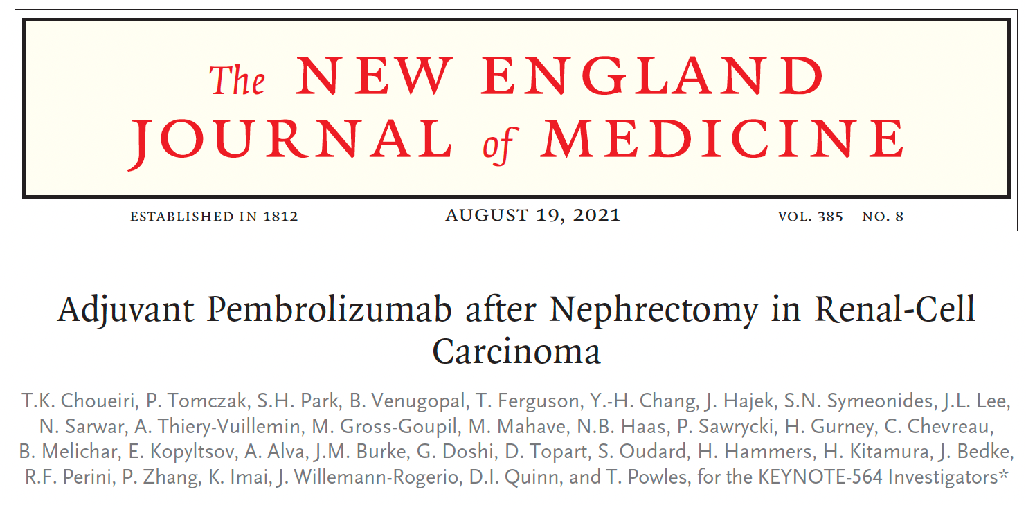

Slide 46
KN564 adjuvant pembro for histologically confirmed locoregional renal cell carcinoma with a clear-cell component
Patients at high risk of recurrence (pT2 with nuclear grade 4 or sarcomatoid differentiation; pT3 or higher, regional lymph-node metastasis, or stage M1 with NED)

Slide 47
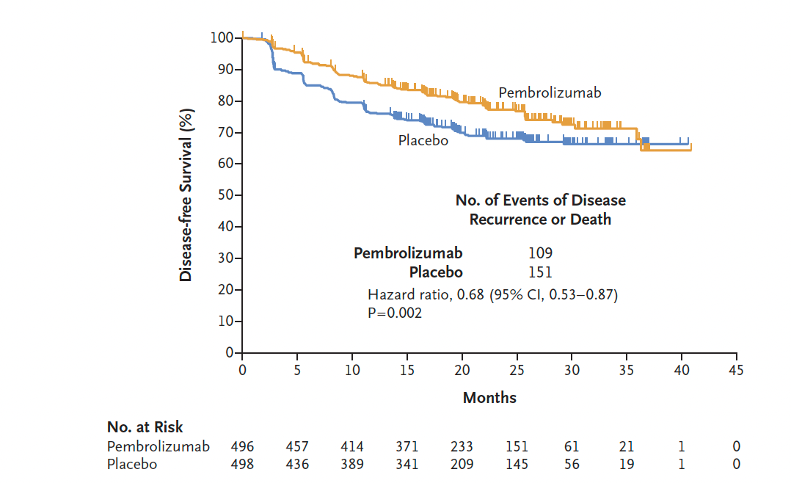
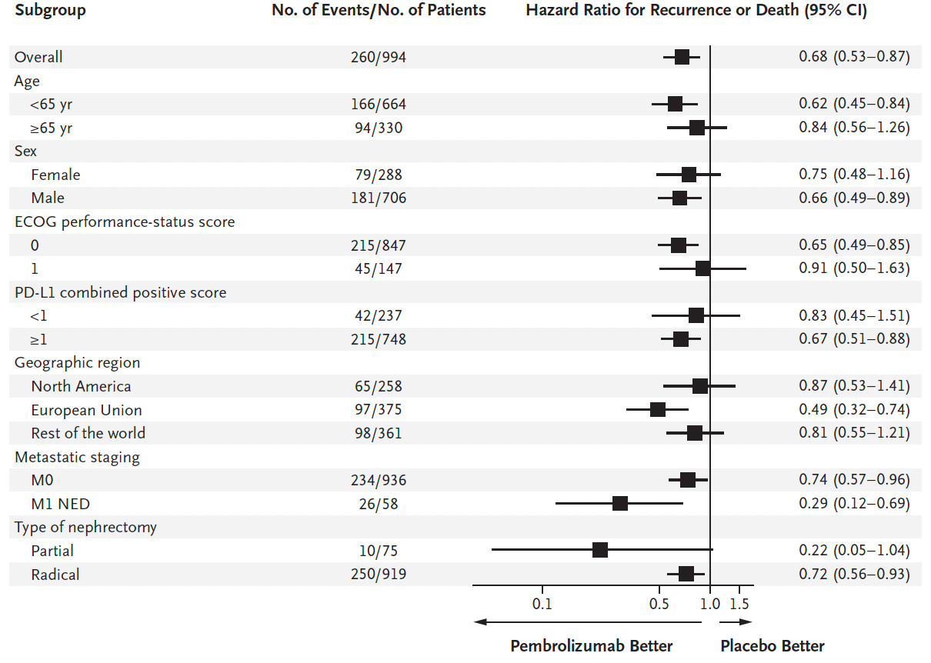

Slide 48
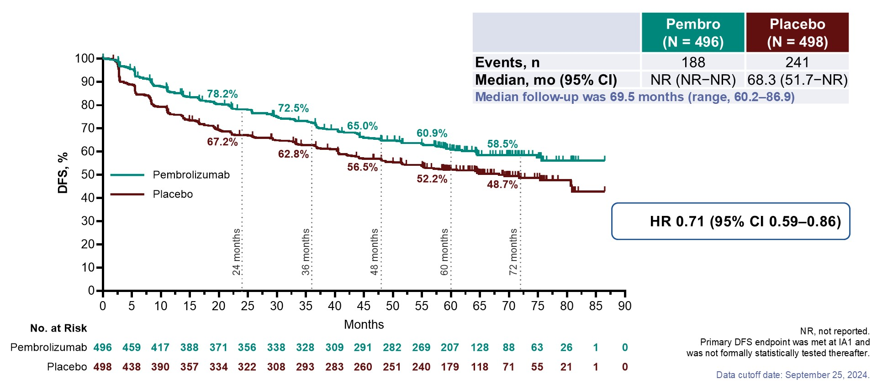
Phase III KEYNOTE-564: 5-Year Updated Disease-Free Survival
Haas NB et al. ASCO 2025;Abstract 4515

Slide 49
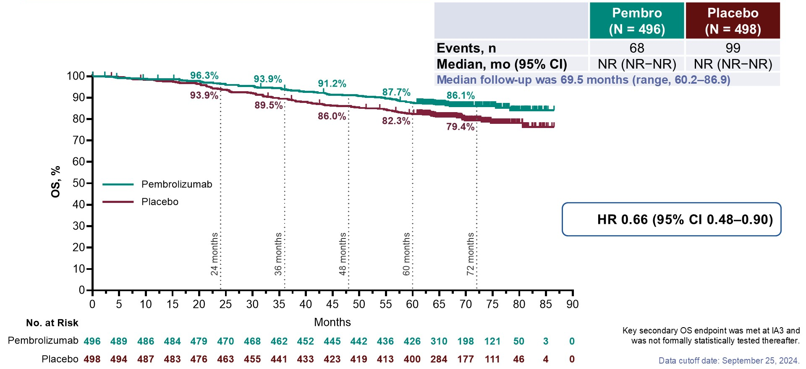
Phase III KEYNOTE-564: 5-Year Updated Overall Survival
Haas NB et al. ASCO 2025;Abstract 4515

Slide 50
Future Directions
Analyses of completed IO trials: KN564, PROSPER, Litespark 022
Support ongoing adjuvant trial (STRIKE: adjuvant pembro +/- tivo)
Participate in planning of periop trials (NEOSHIFT)

Slide 51
Future Directions
Consider frailty and opportunities for prehabilitation (CARE clinic)
Competing mortality risk
Nomogram for risk of irAE

Slide 52
What do I do?
Discuss the possibility of adjuvant therapy with all cT2-3 patients prior to surgery
Discuss KN564 data with all eligible patients post-op
Discuss STRIKE trial with all eligible patients

Slide 53
What do I do?
Discuss the possibility of adjuvant therapy with all cT2-3 patients prior to surgery
Discuss KN564 data with all eligible patients post-op
Discuss STRIKE trial with all eligible patients
Options: surveillance, Pembro monotherapy, Pembro +/- Tivo

Slide 54
Why is Risk Stratification Needed?
Right and good healing action

Slide 55
Why is Risk Stratification Needed?
Right and good healing action
Risk of Cancer Recurrence/Mortality
Patient
Risk of Competing Mortality
Risk of Severe irAE

Slide 56
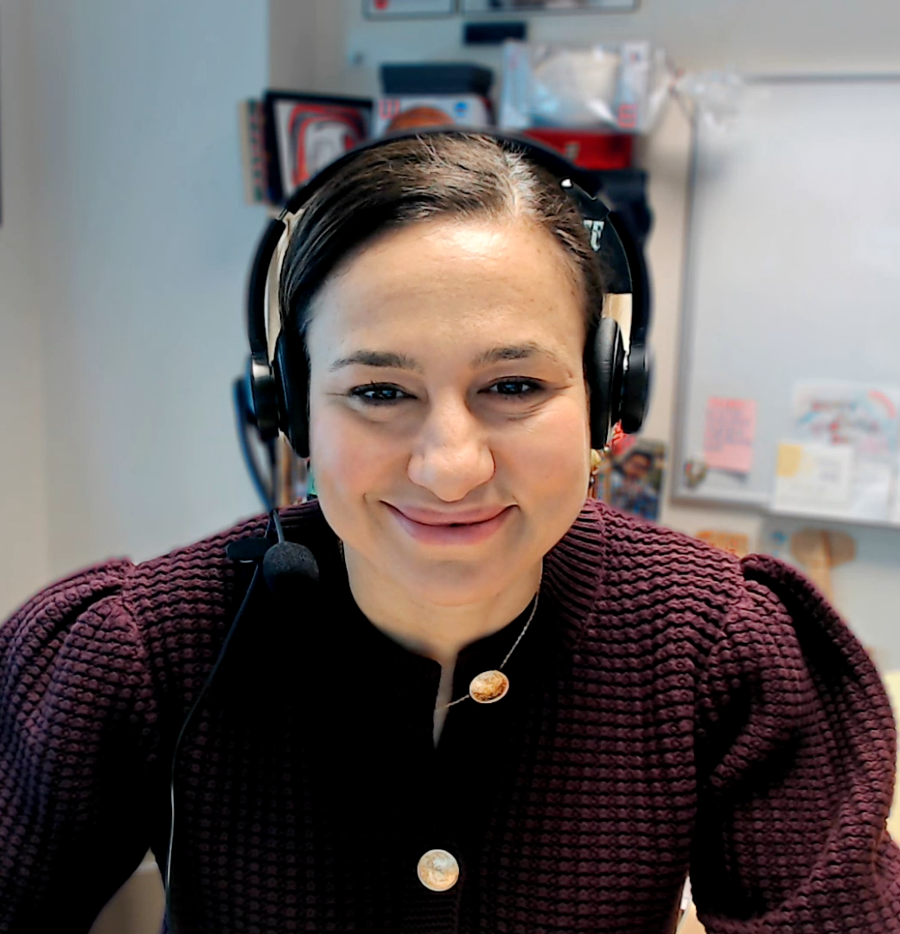
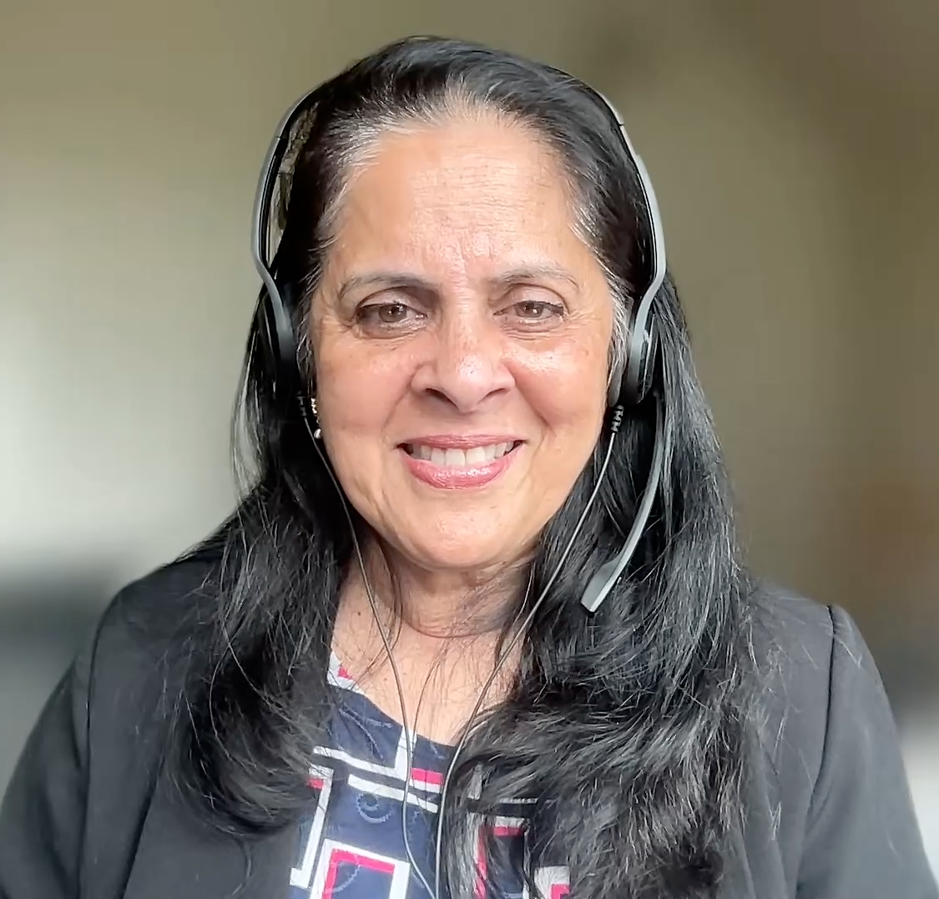
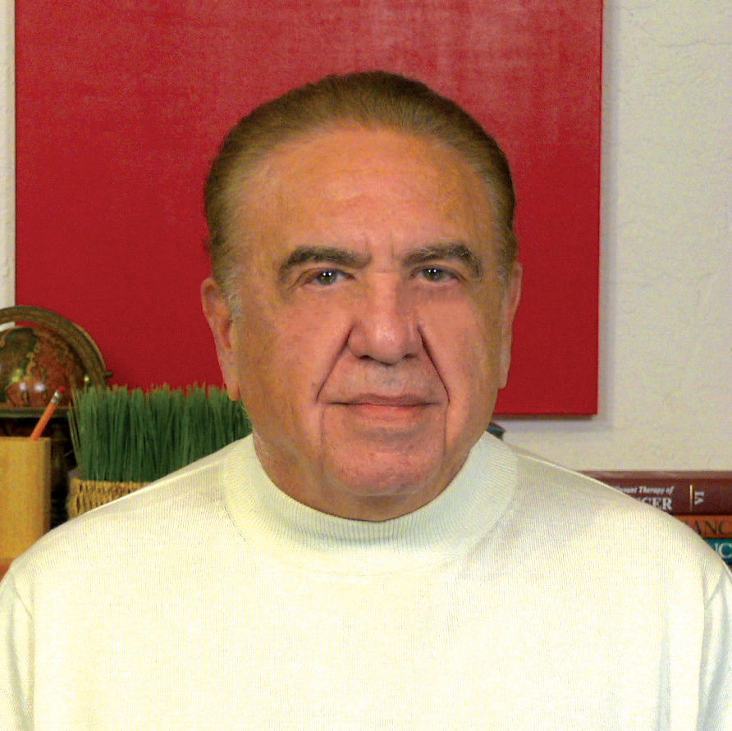
Second Opinion
Rana R McKay, MD, FASCO
Sandy Srinivas, MD
Neil Love, MD

Slide 57
QUESTIONS FOR THE FACULTY
Which risk stratification models do you utilize when evaluating patients for consideration of adjuvant therapy?
In which situations, if any, do you assess ctDNA in the localized or metastatic RCC setting? Which assay or type of assay do you believe is most useful?
What is your usual approach to patients with resected M1 disease in terms of monitoring and the use of “pseudoadjuvant”systemic treatment?

Slide 58
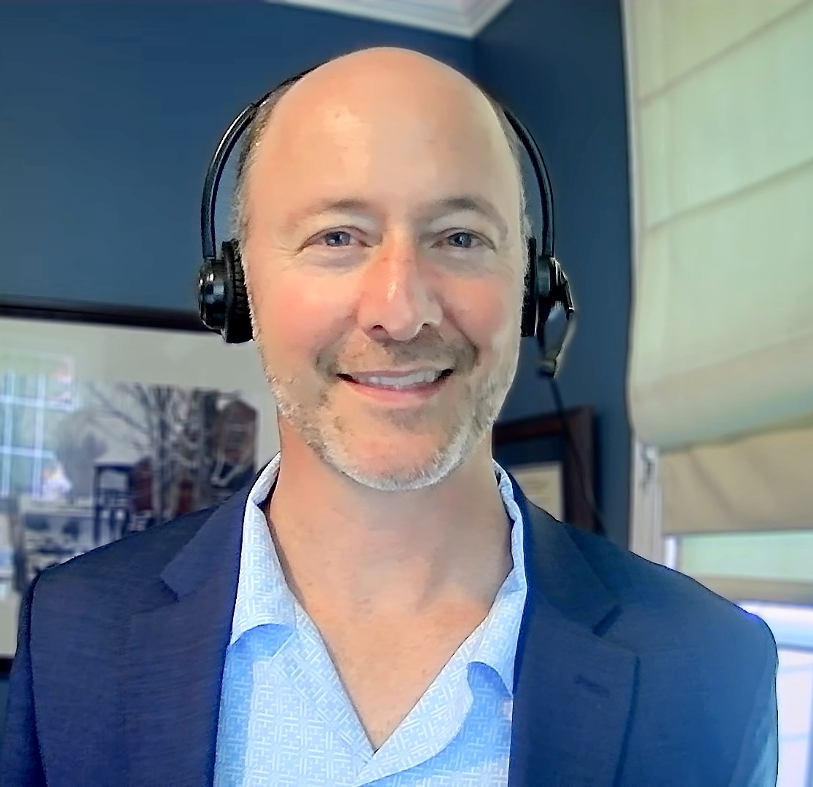
Second Opinion
Andrew J Armstrong, MD, ScM
Rana R McKay, MD, FASCO
Neil Love, MD

Slide 59
QUESTIONS FOR THE FACULTY
Regulatory and reimbursement issues aside, how would you deploy the following in adjuvant and “pseudoadjuvant” situations?
Observation
Pembrolizumab
Pembrolizumab/belzutifan
Regardless of your recommendation, would you discuss these 3 options with all eligible patients?

Slide 60
Agenda
Module 1: Current Indications for Adjuvant Immune Checkpoint Inhibitor Therapy in the Management of Renal Cell Carcinoma (RCC) — Dr Singer
Module 2: Potential Role of Hypoxia-Inducible Factor-2 Alpha (HIF-2α) Inhibitors as a Component of Adjuvant Treatment — Dr Hutson
Module 3: Tolerability of Current and Emerging Adjuvant Approaches for RCC — Dr Vaishampayan

Slide 61

Potential Role of Hypoxia-Inducible
Factor-2 Alpha (HIF-2α) Inhibitors as a
Component of Adjuvant Treatment
Thomas E Hutson, DO, PharmD, PhD FACP FASCO
Medical Oncology – Clinical Research/Drug Development
SCRI- GU Executive and Bridge Committees

Slide 62
TOPICS
Biological rationale for targeting HIF-2α in patients with RCC; mechanism of action of belzutifan
Outcomes achieved with belzutifan in patients with advanced RCC and those with von Hippel-Lindau-associated disease
Proposed synergy between belzutifan and PD-1 blockade by pembrolizumab
Recently presented findings from the Phase III LITESPARK-022 trial assessing the addition of belzutifan to pembrolizumab in the adjuvant setting for patients with high-risk clear cell RCC

Slide 63
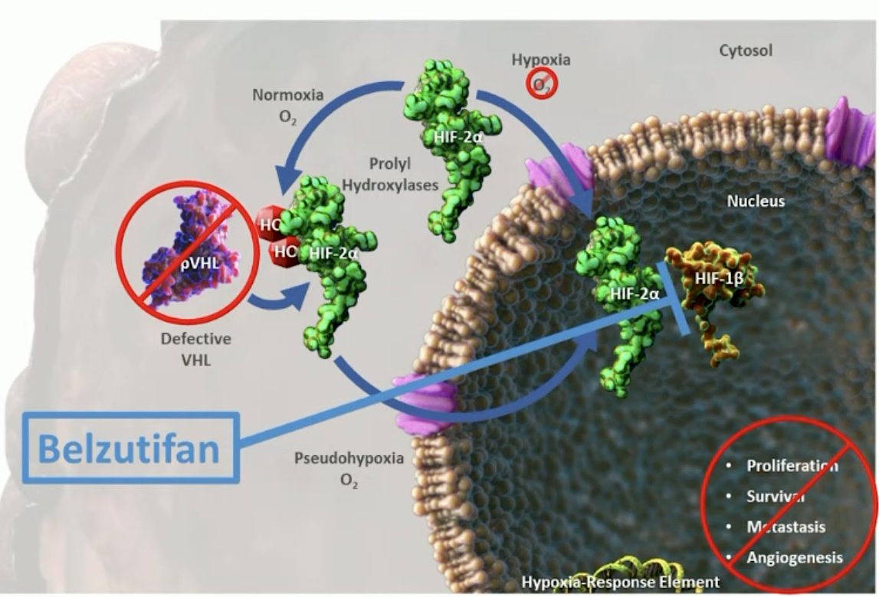
Biologic Rationale for targeting HIF-2a in patients with RCC: MOA

Slide 64
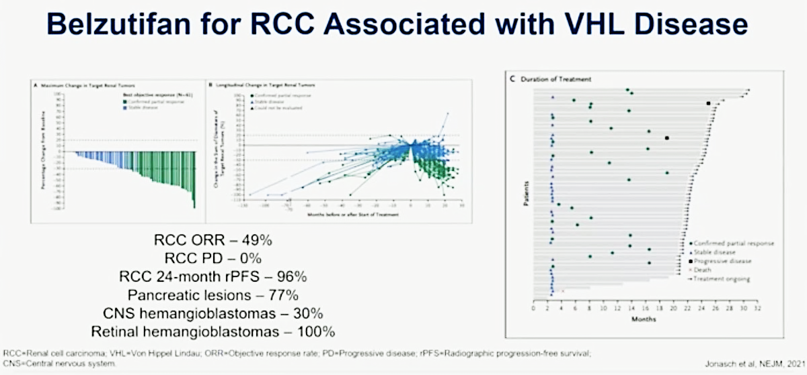
Belzutifan in VHL

Slide 65
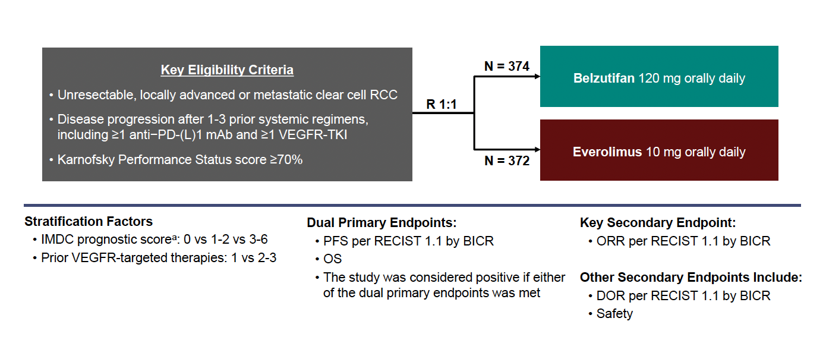
Belzutifan in mRCC: LITESPARK-005
Rini BI et al. ESMO 2024;Abstract LBA74.

Slide 66
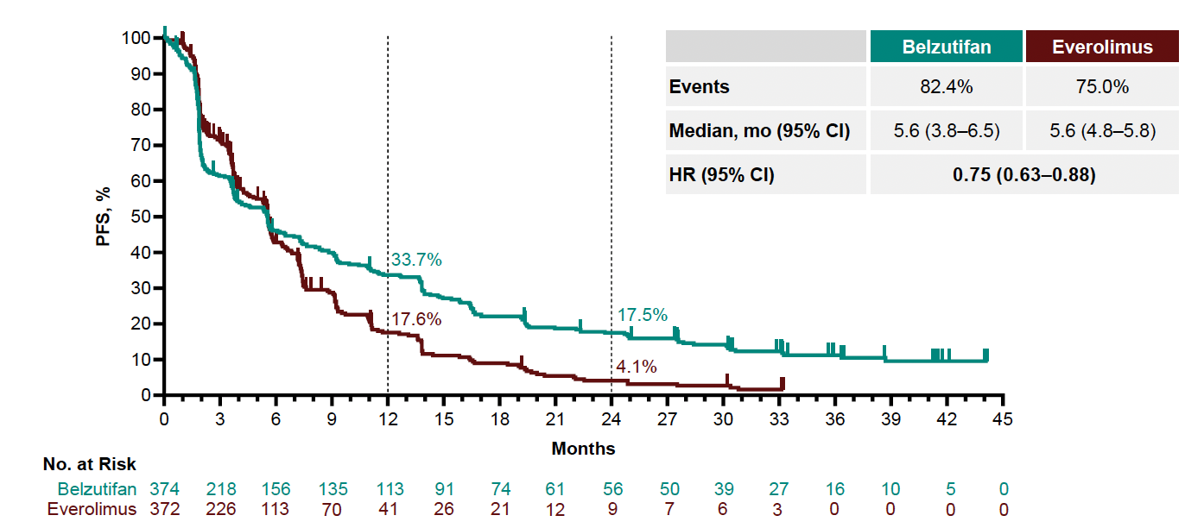
LITESPARK-005: PFS
Rini BI et al. ESMO 2024;Abstract LBA74.

Slide 67
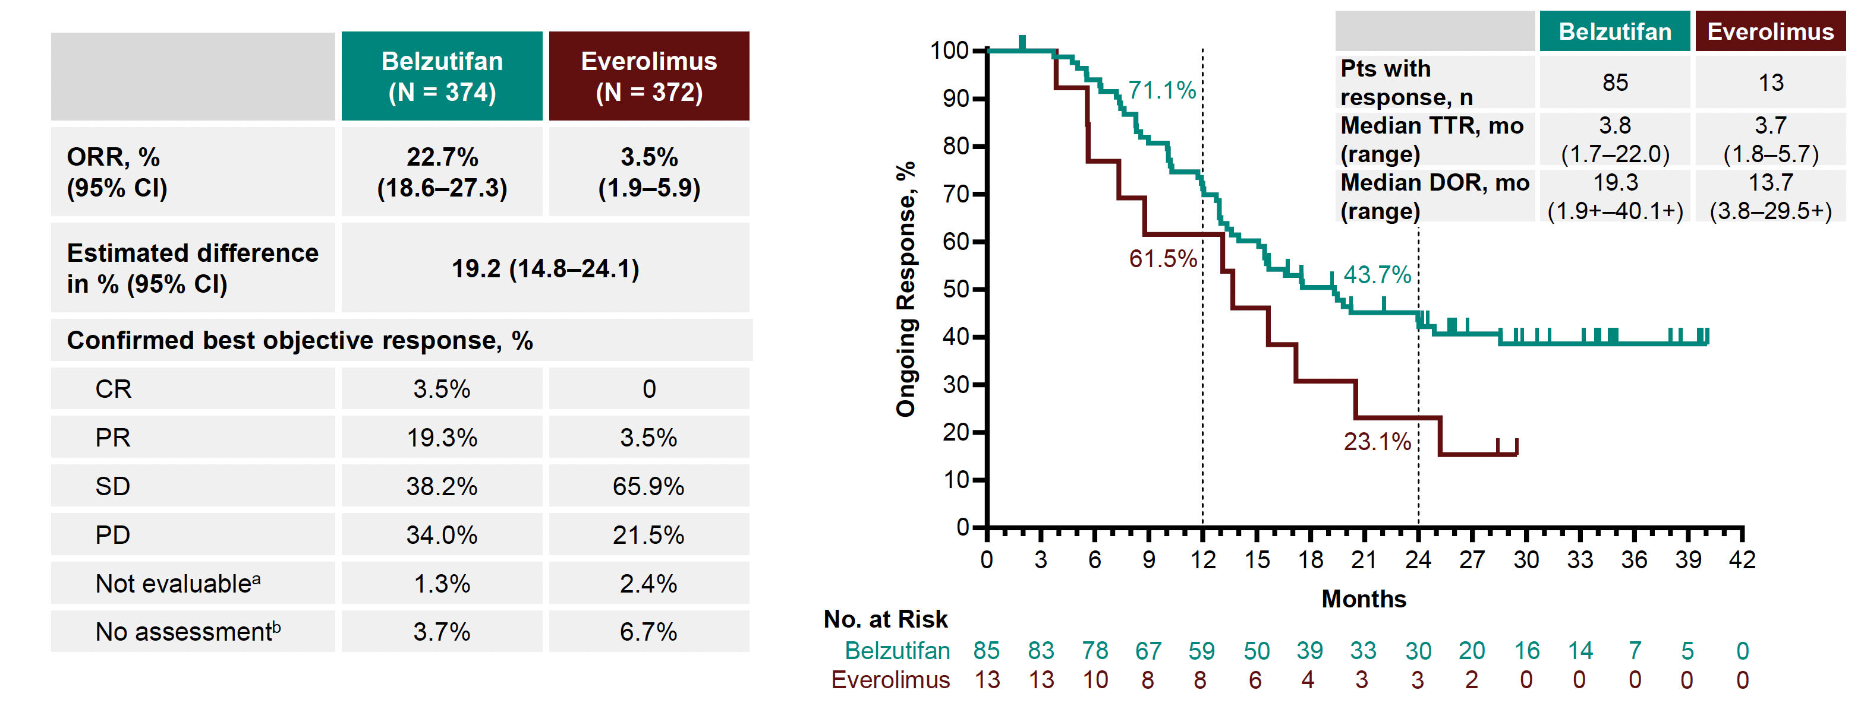
LITESPARK-005: ORR and DOR
Rini BI et al. ESMO 2024;Abstract LBA74.

Slide 68
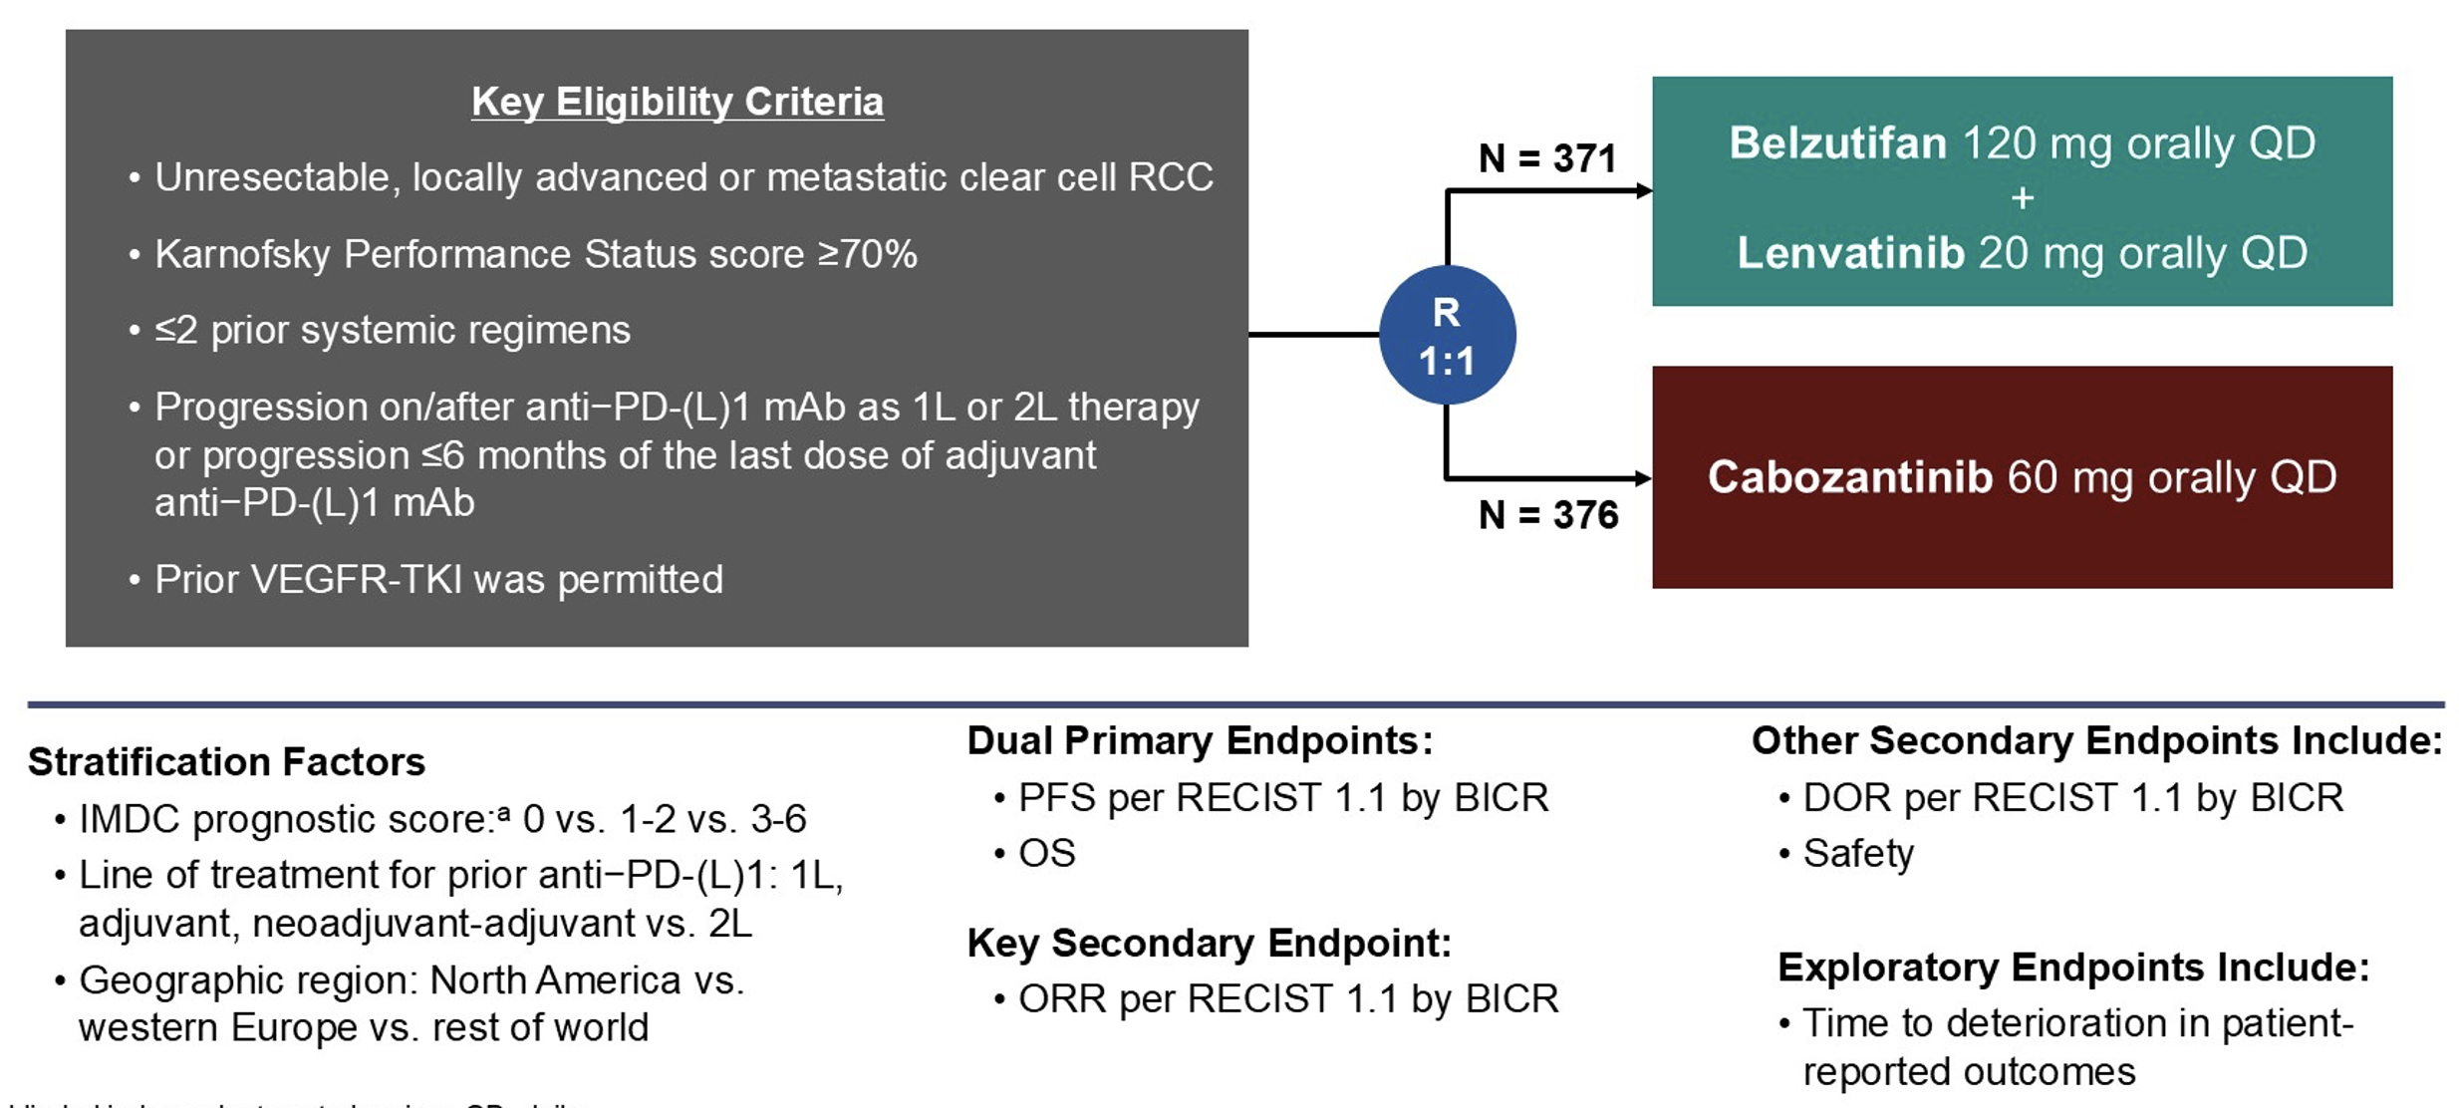
Belzutifan + Lenvatinib in mRCC: LITESPARK-011
Motzer RJ et al. ASCO GU 2026;Abstract LBA417.

Slide 69
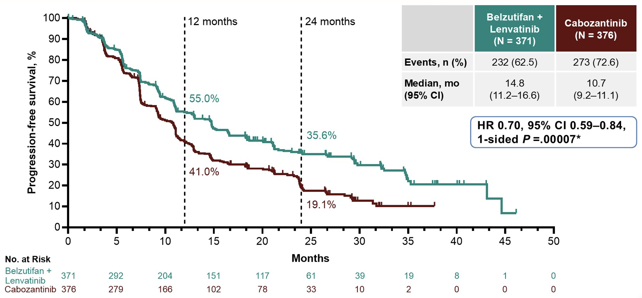
LITESPARK-011: PFS
Motzer RJ et al. ASCO GU 2026;Abstract LBA417.

Slide 70
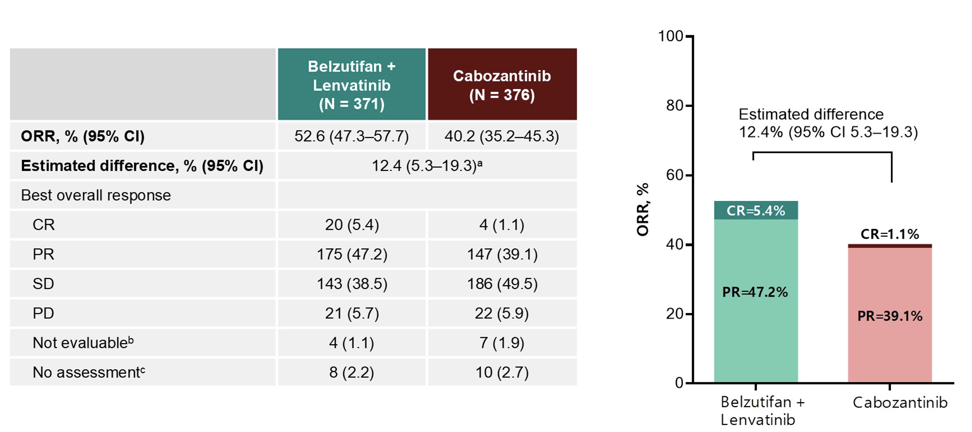
LITESPARK-011: ORR
Motzer RJ et al. ASCO GU 2026;Abstract LBA417.

Slide 71
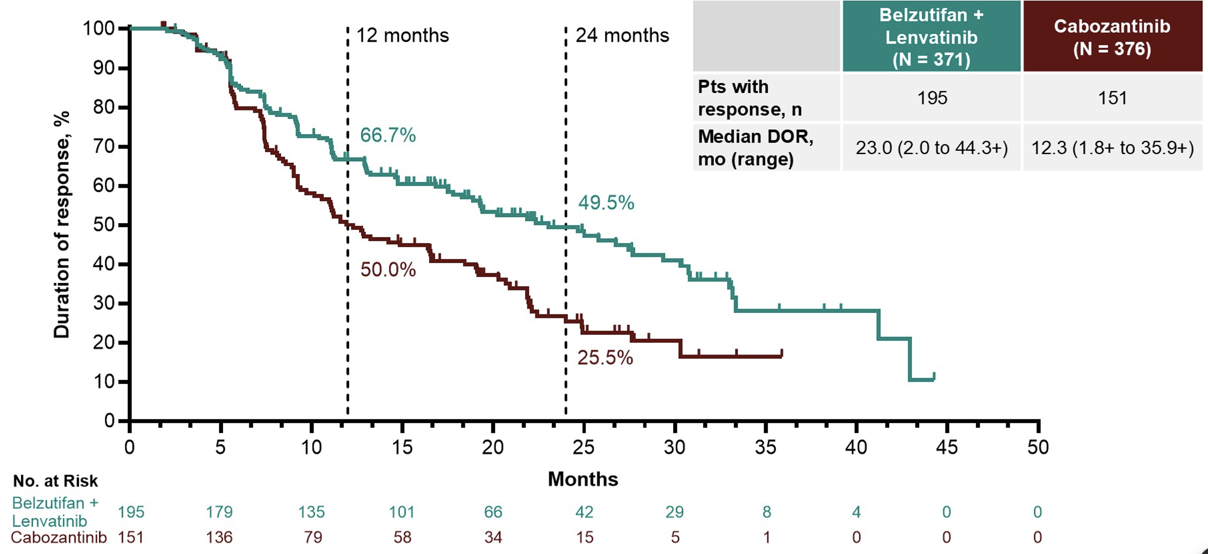
LITESPARK-011: DOR
Motzer RJ et al. ASCO GU 2026;Abstract LBA417.

Slide 72
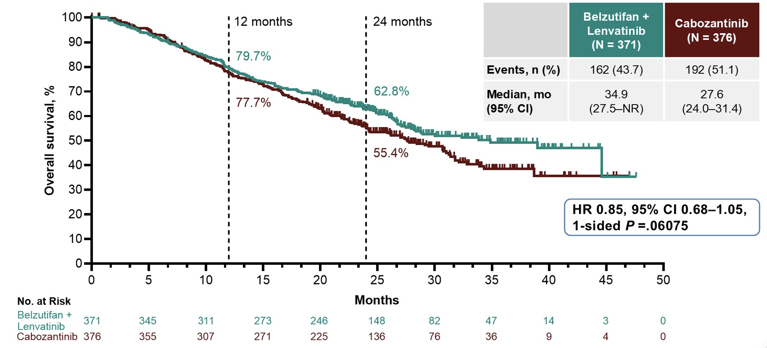
LITESPARK-011: OS
Motzer RJ et al. ASCO GU 2026;Abstract LBA417.

Slide 73
Proposed Synergy between Belzutifan and Pembro

Slide 74
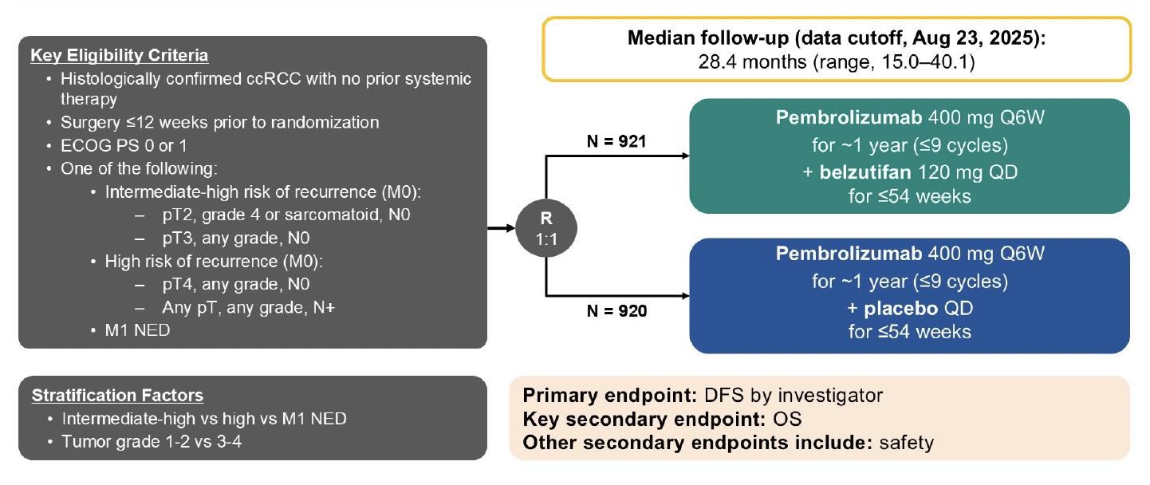
Phase 3 LITESPARK-022: Adjuvant Pembrolizumab + Belzutifan
Choueiri TK et al. ASCO GU 2026;Abstract LBA418.

Slide 75
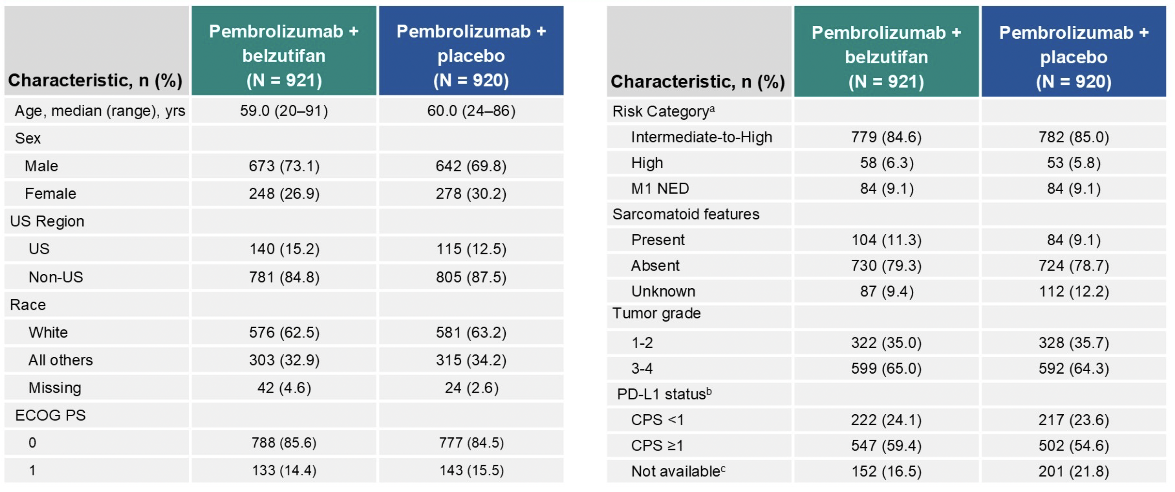
Phase 3 LITESPARK-022: Patient Characteristics
Choueiri TK et al. ASCO GU 2026;Abstract LBA418.

Slide 76
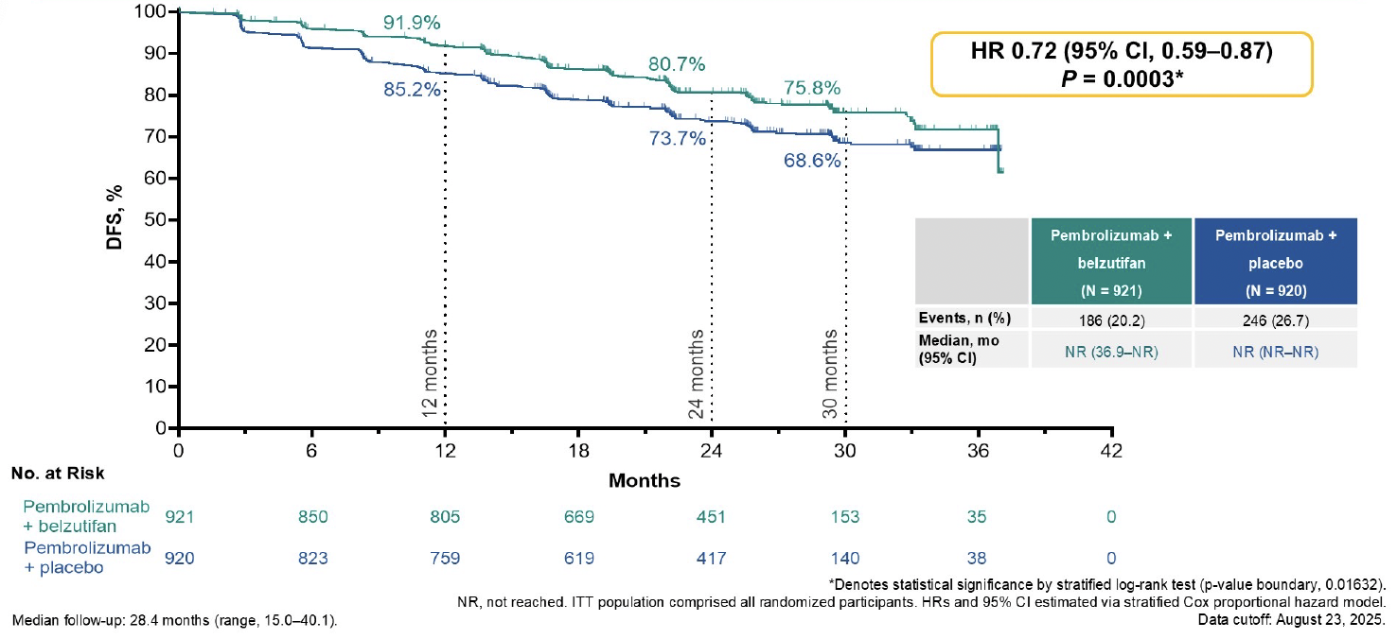
Phase 3 LITESPARK-022: DFS
Choueiri TK et al. ASCO GU 2026;Abstract LBA418.

Slide 77
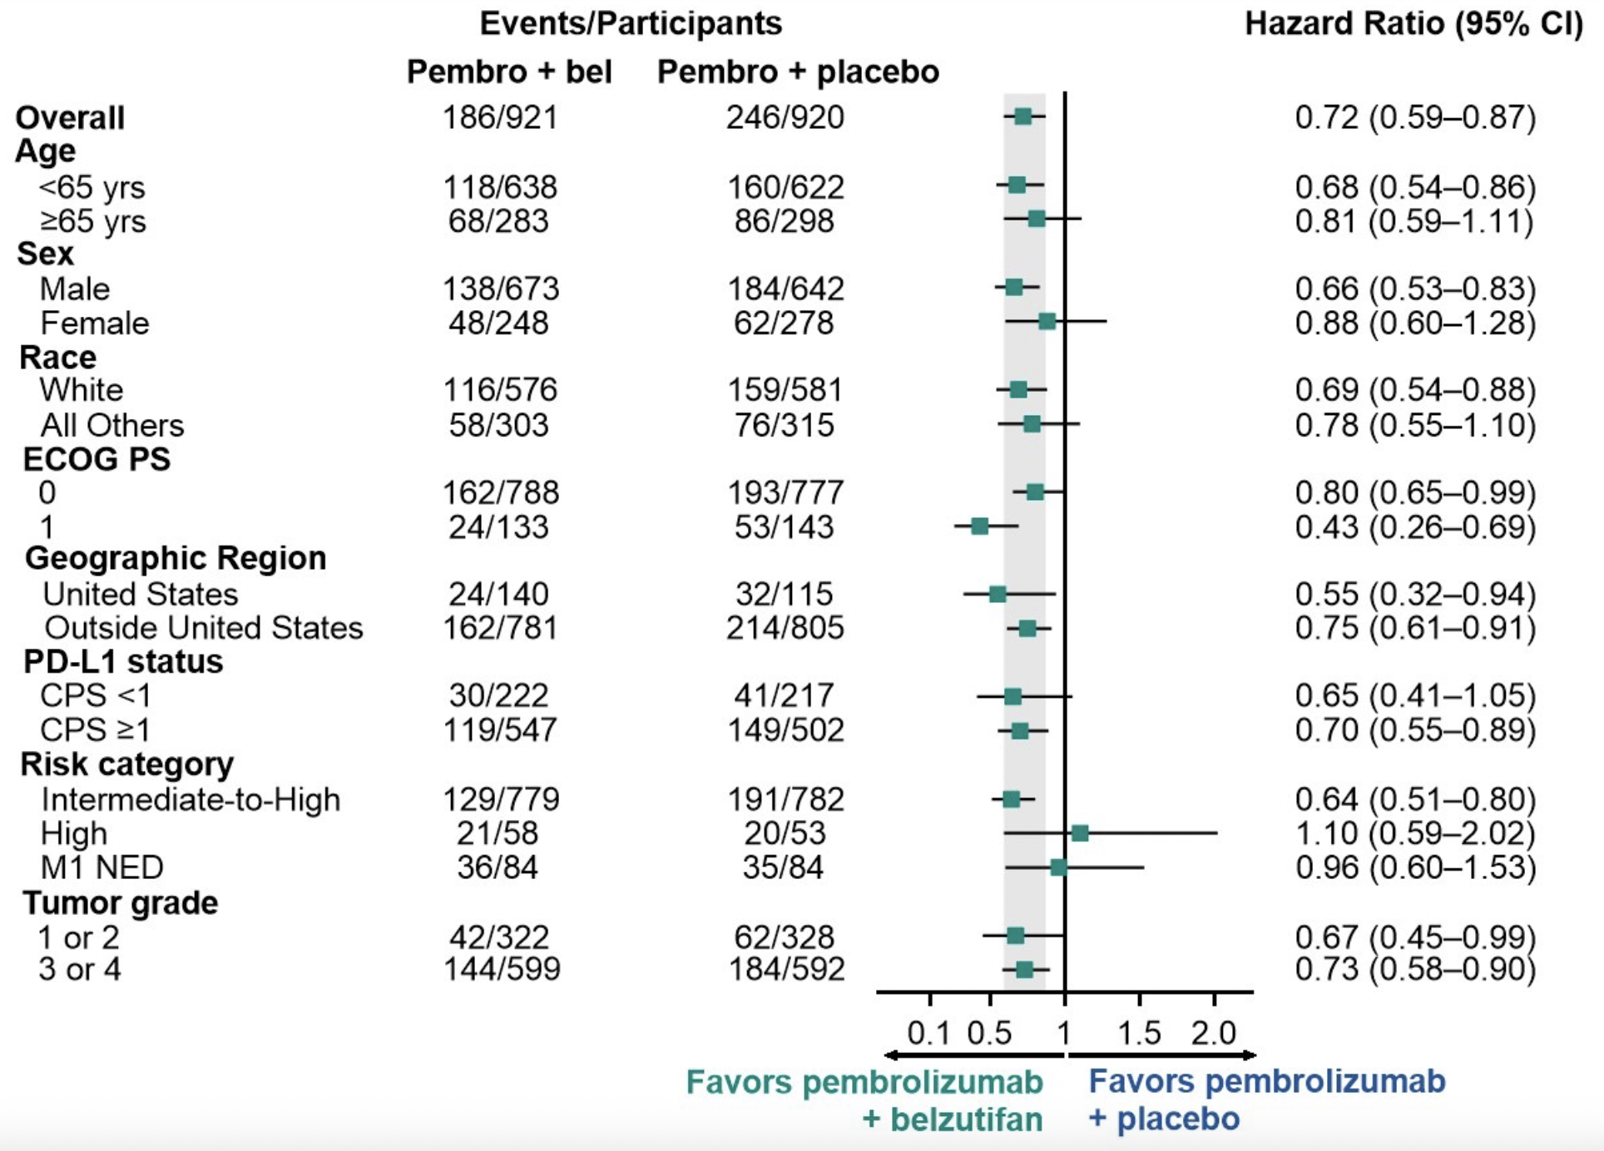
Phase 3 LITESPARK-022: DFS Subgroup Analysis
Choueiri TK et al. ASCO GU 2026;Abstract LBA418.

Slide 78
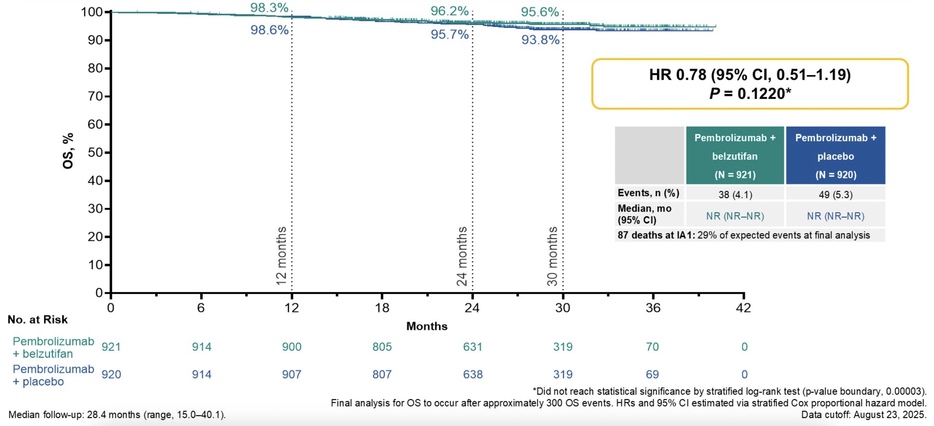
Phase 3 LITESPARK-022: Interim OS
Choueiri TK et al. ASCO GU 2026;Abstract LBA418.

Slide 79
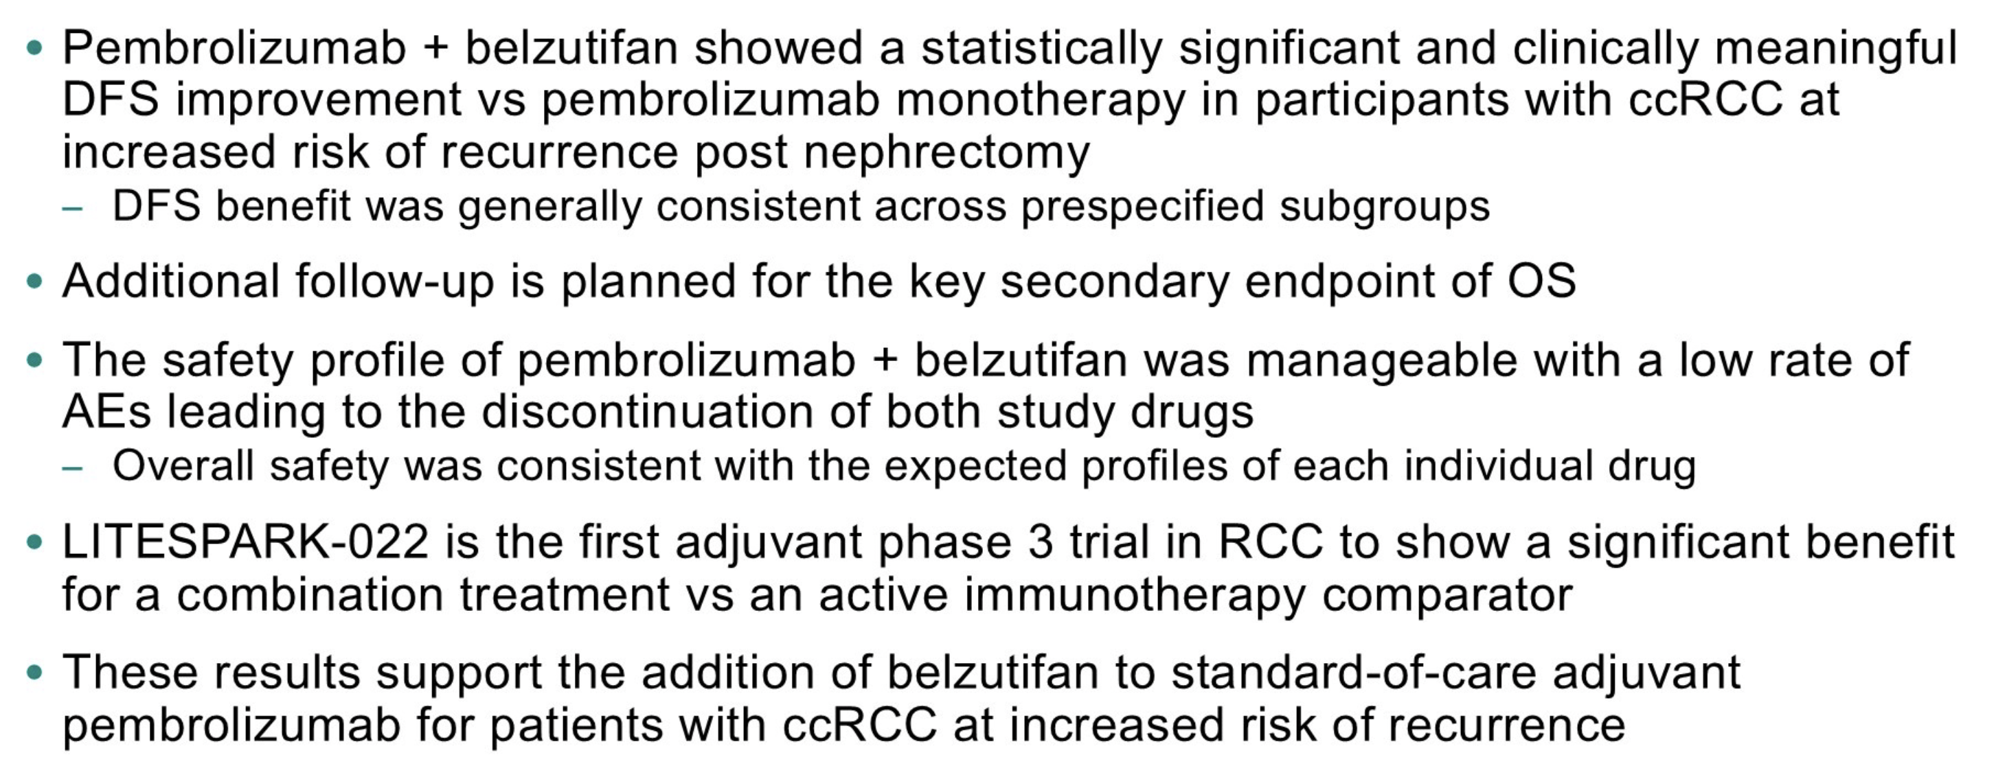
Phase 3 LITESPARK-022: Summary
Choueiri TK et al. ASCO GU 2026;Abstract LBA418.

Slide 80
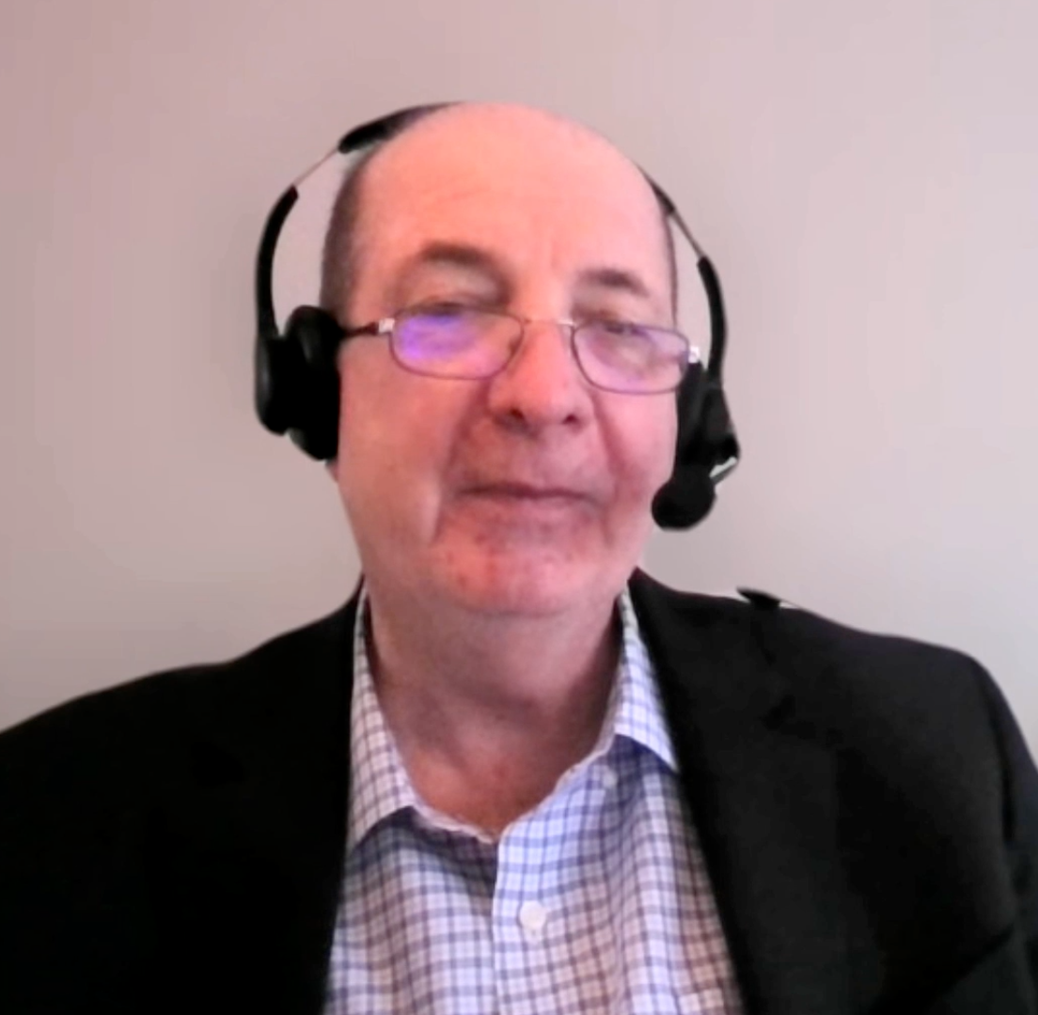
Second Opinion
Robert J Motzer, MD
Neil Love, MD

Slide 81
QUESTIONS FOR THE FACULTY
Based on available data, would you like to be able to administer adjuvant pembrolizumab/belzutifan to any of your patients at this time, or would you prefer to wait until overall survival has been documented? If yes, which specific patients?
Would you consider reserving belzutifan for the second-line or later metastatic setting based on the data from the LITESPARK-005 or LITESPARK-011 studies? In general, what are your thoughts on rechallenging with belzutifan if a patient previously received adjuvant pembrolizumab/belzutifan?

Slide 82
Second Opinion
Andrew J Armstrong, MD, ScM
Sandy Srinivas, MD
Rana R McKay, MD, FASCO
Neil Love, MD

Slide 83
QUESTIONS FOR THE FACULTY
What comorbidities, if any, do you consider relative or absolute contraindications to the use of belzutifan in the adjuvant setting?
How do you approach the use of belzutifan for patients living at high altitudes? How do you define high altitude, and do you hold the drug for patients who travel to these areas?
How will you approach the prevention and management of anemia in patients receiving belzutifan in the adjuvant setting?
What is the minimum baseline Hb for which you would use the drug?
Is there any particular advice you give to patients regarding diet and exercise while receiving adjuvant pembrolizumab/belzutifan?

Slide 84
Agenda
Module 1: Current Indications for Adjuvant Immune Checkpoint Inhibitor Therapy in the Management of Renal Cell Carcinoma (RCC) — Dr Singer
Module 2: Potential Role of Hypoxia-Inducible Factor-2 Alpha (HIF-2α) Inhibitors as a Component of Adjuvant Treatment — Dr Hutson
Module 3: Tolerability of Current and Emerging Adjuvant Approaches for RCC — Dr Vaishampayan

Slide 85

Tolerability of Current and Emerging Adjuvant Approaches for RCC
Ulka Vaishampayan, M.D.
Director of Phase I Therapeutics
Rogel Cancer Center
Professor of Medicine/GU Oncology
University of Michigan School of Medicine
Ann Arbor MI

Slide 86

KEYNOTE-564: Study Design
Haas N et al. ASCO 2025

Slide 87

KEYNOTE-564: Updated Safety Findings at Five-Year Follow Up
Haas N et al. ASCO 2025

Slide 88

KEYNOTE-564: Updated Safety Findings at Five-Year Follow Up
Haas N et al. ASCO 2025

Slide 89

NCCN Guidelines: Management of ICI-Related Toxicities
NCCN Guidelines. Version 1.2026. Management of ICI-Related Toxicities

Slide 90

NCCN Guidelines: Management of ICI-Related Toxicities
NCCN Guidelines. Version 1.2026. Management of ICI-Related Toxicities

Slide 91

NCCN Guidelines: Management of ICI-Related Toxicities
NCCN Guidelines. Version 1.2026. Management of ICI-Related Toxicities

Slide 92

NCCN Guidelines: Management of ICI-Related Toxicities
NCCN Guidelines. Version 1.2026. Management of ICI-Related Toxicities

Slide 93

ASCO Guideline Update: Managing irAEs from ICIs
Schneider BJ et al. JCO 2021

Slide 94
NCCN Guidelines: Management of ICI-Related Toxicities
What about patients with pre-existing autoimmune/viral conditions or organ transplant recipients?
History of HIV or viral hepatitis? Possibly
Pre-existing autoimmune conditions? Possibly
Organ transplant recipients? Possibly
Prior allogeneic HCT? Possibly
Autoimmune neurologic conditions? Probably not
Life-threatening autoimmune disorders? Probably not
NCCN Guidelines. Version 1.2026. Management of ICI-Related Toxicities; Schneider BJ et al. JCO 2021

Slide 95

LITESPARK-005 Study: Design
Rini B et al. ESMO 2024

Slide 96

LITESPARK-005 Study: Summary of AEs
Rini B et al. ESMO 2024

Slide 97

LITESPARK-005 Study: Time to Onset of Any-Grade AEs
Rini B et al. ESMO 2024

Slide 98

LITESPARK-005 Study: Duration of Any-Grade AEs
Rini B et al. ESMO 2024

Slide 99


Belzutifan at High Altitudes
McFarland et al. ASCO GU 2026; Abstract 488.

Slide 100

Belzutifan at High Altitudes
McFarland et al. ASCO GU 2026; Abstract 488.

Slide 101
Managing AEs from Belzutifan
Adverse Reaction | Severity | Dosage Modification
Anemia | Hemoglobin <8 g/dL or transfusion indicated | Withhold until hemoglobin ≥8g/dL Resume at the same or reduced dose; or d/c depending on severity of anemia
 | Life-threatening or urgent intervention indicated | Withhold until hemoglobin ≥8g/dL Resume at a reduced dose or permanently d/c
Hypoxia | Decreased O2 saturation with exercise | Consider withholding until resolved Resume at the same dose or at a reduced dose depending on the severity of hypoxia
 | Decreased O2 saturation at rest | Withhold until resolved Resume at reduced dose or d/c depending on severity of hypoxia
 | Life-threatening or recurrent symptomatic hypoxia | Permanently discontinue
Other adverse reactions | Grade 3 | Withhold dosing until resolved to ≤ G2 Consider resuming at reduced dose Permanently d/c upon recurrence of G3
 | Grade 4 | Permanently d/c
Belzutifan PI, 2025.

Slide 102

LITESPARK-022 Study: Design
Choueiri TK et al. ASCO GU 2026

Slide 103

LITESPARK-022 Study: irAE and TRAEs leading to discontinuation
Choueiri TK et al. ASCO GU 2026

Slide 104

LITESPARK-022 Study: All Grade AEs
Choueiri TK et al. ASCO GU 2026

Slide 105

LITESPARK-022: Anemia-Related AEs
Choueiri TK et al. ASCO GU 2026

Slide 106

LITESPARK-022: Hypoxia-Related AEs
Choueiri TK et al. ASCO GU 2026

Slide 107
Core Principles of Adjuvant Therapy
Targeting Micrometastatic Disease: The primary goal is to destroy "hidden" cancer cells that are too small to be seen on scans or during surgery. These cells, if left untreated, can lead to local recurrence or distant metastasis.
Risk-Benefit Assessment: Decisions are tailored to the patient's individual risk profile. Doctors consider the likelihood of recurrence against the potential side effects and impact on the patient's quality of life.
Patient Evaluation: Healthy asymptomatic patient with a long Life expectancy
Evidence-Based Selection: Recommendations are based on rigorous clinical trials that demonstrate improvements in Disease-Free Survival (DFS) or Overall Survival (OS) for specific cancer types and stages.

Slide 108

Risk Profiling and Patient selection is Key!

Slide 109

Conclusions: Shared Decision Making
Benefits:
With pembro +bel: Relapse free survival: 7% increase with belzutifan Overall survival: no difference
With pembro 9% RFS and 5% OS benefit
Risks:
Severe Anemia-12%
Deaths 1.1%
IRAE > grade 3-8-9%. Can be life long.
4) Cost

Slide 110
Second Opinion
Robert J Motzer, MD
Neil Love, MD

Slide 111
QUESTIONS FOR THE FACULTY
Do you have any predictions or comments about the ongoing Phase III STRIKE trial evaluating adjuvant pembrolizumab in combination with tivozanib?
How optimistic are you that mRNA-based personalized neoantigen vaccines will play a role in the adjuvant RCC setting in the near future?

Slide 112
Second Opinion
Robert J Motzer, MD
Neil Love, MD

Slide 113
QUESTIONS FOR THE FACULTY
Regulatory and reimbursement issues aside, what is your current preferred second-line treatment for metastatic RCC, and where do you see the combination of lenvatinib/belzutifan fitting in?

Slide 114
Second Opinion: Investigators Provide Perspectives on the Current and Future Management of Prostate Cancer
Part 2 of a 2-Part CME Satellite Symposium Series Held in Conjunction with
the 2026 American Urological Association Annual Meeting (AUA2026)
Sunday, May 17, 2026
5:30 PM – 7:30 PM ET
Faculty
Neeraj Agarwal, MD, FASCO
Daniel P Petrylak, MD
Fred Saad, CQ, MD
Neal D Shore, MD
Moderator
Elisabeth I Heath, MD

Slide 115
Thank you for joining us! Please take a moment to complete the survey currently up on Zoom. Your feedback is very important to us. The survey will remain open up to 5 minutes after the meeting ends.
To Claim CME Credit
In-person attendees: Please refer to the program syllabus for the CME credit link or QR code.
Virtual attendees: The CME credit link is posted in the chat room.
CME credit information will be emailed to each participant within 1 to 2 business days.

