Slide 1
The Implications of Recent Datasets for the Current and Future Management of Genitourinary Cancers — An ASCO 2026 Review
A CME/MOC-Accredited Live Webinar
Thursday, July 16, 2026
5:00 PM – 6:30 PM ET
Faculty
Rahul Aggarwal, MD
Matthew D Galsky, MD
Tian Zhang, MD, MHS, FASCO
Moderator
Neil Love, MD

Slide 2




Faculty
Rahul Aggarwal, MD
Professor of Medicine and Thomas Perkins Distinguished Professor of Cancer Research
Program Leader, Genitourinary Medical Oncology
Division of Hematology/Oncology
University of California, San Francisco
Associate Director for Clinical Research
UCSF Helen Diller Family Comprehensive Cancer Center
San Francisco, California
Tian Zhang, MD, MHS, FASCO
Associate Professor
Director of Clinical Research
Division of Hematology and Oncology
Department of Internal Medicine
UT Southwestern Medical Center
Associate Director for Clinical Research
Simmons Comprehensive Cancer Center
Dallas, Texas
Matthew D Galsky, MD
Lillian and Howard Stratton Professor of Medicine
Icahn School of Medicine at Mount Sinai
Deputy Director
The Mount Sinai Tisch Cancer Center
New York, New York
MODERATOR
Neil Love, MD
Research To Practice
Miami, Florida

Slide 3
Commercial Support
This activity is supported by educational grants from AstraZeneca Pharmaceuticals LP, Exelixis Inc, Johnson & Johnson, and Novartis.

Slide 4
Dr Love — Disclosures
Dr Love is president and CEO of Research To Practice. Research To Practice receives funds in the form of educational grants to develop CME activities from the following companies: Aadi Bioscience, AbbVie Inc, ADC Therapeutics, Agendia Inc, Alexion Pharmaceuticals, Amgen Inc, Array BioPharma Inc, a subsidiary of Pfizer Inc, Arvinas, Astellas, AstraZeneca Pharmaceuticals LP, Aveo Pharmaceuticals, Bayer HealthCare Pharmaceuticals, BeOne, Biotheranostics Inc, A Hologic Company, Black Diamond Therapeutics Inc, Blueprint Medicines, Boehringer Ingelheim Pharmaceuticals Inc, Bristol Myers Squibb, Catalyst Pharmaceuticals Inc, Celcuity, Clovis Oncology, Coherus BioSciences, Corcept Therapeutics Inc, CTI BioPharma, a Sobi Company, Daiichi Sankyo Inc, Eisai Inc, Elevation Oncology Inc, Exact Sciences Corporation, Exelixis Inc, Genentech, a member of the Roche Group, Genmab US Inc, Geron Corporation, Gilead Sciences Inc, GSK, Helsinn Therapeutics (US) Inc, ImmunoGen Inc, Incyte Corporation, Ipsen Biopharmaceuticals Inc, Jazz Pharmaceuticals Inc, Johnson & Johnson, Karyopharm Therapeutics, Kite, A Gilead Company, Kura Oncology, Legend Biotech, Lilly, MEI Pharma Inc, Merck, Mersana Therapeutics Inc, Mirati Therapeutics Inc, Mural Oncology Inc, Natera Inc, Novartis, Novartis Pharmaceuticals Corporation on behalf of Advanced Accelerator Applications, Novocure Inc, Nuvalent, Nuvation Bio Inc, Pfizer Inc, Pharmacyclics LLC, an AbbVie Company, Puma Biotechnology Inc, Regeneron Pharmaceuticals Inc, Revolution Medicines Inc, Rigel Pharmaceuticals Inc, R-Pharm US, Sanofi, Seagen Inc, Servier Pharmaceuticals LLC, SpringWorks Therapeutics Inc, Stemline Therapeutics Inc, Sumitomo Pharma America, Summit Therapeutics, Syndax Pharmaceuticals, Taiho Oncology Inc, Takeda Pharmaceuticals USA Inc, TerSera Therapeutics LLC, Tesaro, A GSK Company, and Verastem Inc.

Slide 5
Research To Practice CME Planning Committee Members,
Staff and Reviewers
Planners, scientific staff and independent reviewers for Research To Practice have no relevant financial relationships to disclose.

Slide 6
Dr Aggarwal — Disclosures
Advisory Committees | AbbVie Inc, Amgen Inc, Bayer HealthCare Pharmaceuticals, Daiichi Sankyo Inc, Merck, Pfizer Inc
Consulting Agreements | Boxer Capital Management, EcoR1 Capital, Genentech, a member of the Roche Group
Contracted Research | Amgen Inc, AstraZeneca Pharmaceuticals LP, Johnson & Johnson, Merck, Novartis, Zenith Epigenetics
Nonrelevant Financial Relationships | Prostate Cancer Clinical Trials Consortium

Slide 7
Dr Galsky — Disclosures
Contracted Research | Astellas, Merck, Seagen Inc
Travel Support | Pfizer Inc

Slide 8
Dr Zhang — Disclosures
Advisory Committees | Amgen Inc, Arcus Biosciences, AstraZeneca Pharmaceuticals LP, Aveo Pharmaceuticals, Bayer HealthCare Pharmaceuticals, Bristol Myers Squibb, Dendreon Pharmaceuticals Inc, Eisai Inc, EMD Serono Inc, Exelixis Inc, Gilead Sciences Inc, Janssen Biotech Inc, Lilly, Merck, Novartis, Pfizer Inc, Sanofi, Summit Therapeutics, Xencor
Consulting Agreements | Aptitude Health, DAVA Oncology, eChinaHealth, Pfizer Inc, Vaniam Group
Contracted Research | ALX Oncology, Arcus Biosciences, Astellas, AstraZeneca Pharmaceuticals LP, Bayer HealthCare Pharmaceuticals, Daiichi Sankyo Inc, Exelixis Inc, Janssen Biotech Inc, Janux Therapeutics, Kura Oncology, Lilly, Merck, OncoC4, Pfizer Inc, Tempus
Data and Safety MonitoringBoards/Committees | Novartis
Nonrelevant Financial Relationships | MJH Life Sciences, PeerView

Slide 9
This educational activity contains discussion of
non-FDA-approved uses of agents and regimens. Please refer to official prescribing information for each product for approved indications.

Slide 10


We Encourage Clinicians in Practice to Submit Questions
Feel free to submit questions now before the program begins and throughout the program.

Slide 11

Familiarizing Yourself with the Zoom Interface
Expand chat submission box
Drag the white line above the submission box up to create
more space for your message.

Slide 12

Familiarizing Yourself with the Zoom Interface
Increase chat font size
Press Command (for Mac) or Control (for PC) and the + symbol.
You may do this as many times as you need for readability.

Slide 13


Clinicians in the Audience, Please Complete the Pre- and Postmeeting Surveys
Quick Survey
Quick Poll

Slide 14


Slide 15
Patterns of Care: Exploring How
Community Oncologists Manage
Metastatic Triple-Negative Breast Cancer
A CME/MOC-Accredited Live Webinar
Tuesday, July 21, 2026
5:00 PM – 6:00 PM ET
Faculty
Professor Peter Schmid, FRCP, MD, PhD
Melinda Telli, MD, FASCO
Moderator
Neil Love, MD

Slide 16
Bringing the Investigator into the Equation
— Optimal Use of Hormonal Therapy in the
Care of Patients with Prostate Cancer
A CME/MOC-Accredited Live Webinar
Wednesday, July 29, 2026
5:00 PM – 6:00 PM ET
Faculty
William K Oh, MD
Mary-Ellen Taplin, MD
Moderator
Neil Love, MD

Slide 17
The Implications of Recent Datasets for the Current and Future Management of Breast Cancer — An ASCO 2026 Review
A CME/MOC-Accredited Live Webinar
Thursday, July 30, 2026
5:00 PM – 6:30 PM ET
Faculty
Kevin Kalinsky, MD, MS, FASCO
Joyce O’Shaughnessy, MD
Additional faculty to be announced.
Moderator
Neil Love, MD

Slide 18
Integrating New Advances into the Care of Patients with Cancer
A Multitumor Symposium in Partnership with the American Oncology Network
Join Us In Person or Virtually
Saturday, August 22, 2026
JW Marriott Nashville | Nashville, Tennessee
Chronic Lymphocytic Leukemia
9:00 AM – 9:50 AM CT
Diffuse Large B-Cell Lymphoma
12:35 PM – 1:25 PM CT
Gastroesophageal Cancers
9:50 AM – 10:40 AM CT
Lung Cancer
1:25 PM – 2:15 PM CT
Gynecologic Cancers
10:55 AM – 11:45 AM CT
Moderator
Stephen “Fred” Divers, MD

Slide 19
Grand Rounds
CME/MOC-Accredited Interactive Series
Regional Activities
Two Series
Optimizing the Use of
Novel Therapies for Patients with Diffuse Large B-Cell Lymphoma
Optimizing Therapy for Patients with Hormone Receptor-Positive
Localized Breast Cancer
Host a 1-hour session at your institution:
Email Meetings@ResearchToPractice.com
or call (800) 233-6153

Slide 20
Thank you for joining us! Please take a moment to complete the survey currently up on Zoom.
Your feedback is very important to us.
Information on how to obtain CME, ABIM MOC and ABS credit will be provided at the conclusion of the activity in the Zoom chat room. Attendees will also receive an email in 1 to 3 business days with these instructions.

Slide 21
The Implications of Recent Datasets for the Current and Future Management of Genitourinary Cancers — An ASCO 2026 Review
A CME/MOC-Accredited Live Webinar
Thursday, July 16, 2026
5:00 PM – 6:30 PM ET
Faculty
Rahul Aggarwal, MD
Matthew D Galsky, MD
Tian Zhang, MD, MHS, FASCO
Moderator
Neil Love, MD

Slide 22
Faculty
Rahul Aggarwal, MD
Professor of Medicine and Thomas Perkins Distinguished Professor of Cancer Research
Program Leader, Genitourinary Medical Oncology
Division of Hematology/Oncology
University of California, San Francisco
Associate Director for Clinical Research
UCSF Helen Diller Family Comprehensive Cancer Center
San Francisco, California
Tian Zhang, MD, MHS, FASCO
Associate Professor
Director of Clinical Research
Division of Hematology and Oncology
Department of Internal Medicine
UT Southwestern Medical Center
Associate Director for Clinical Research
Simmons Comprehensive Cancer Center
Dallas, Texas
Matthew D Galsky, MD
Lillian and Howard Stratton Professor of Medicine
Icahn School of Medicine at Mount Sinai
Deputy Director
The Mount Sinai Tisch Cancer Center
New York, New York
MODERATOR
Neil Love, MD
Research To Practice
Miami, Florida

Slide 23
We Encourage Clinicians in Practice to Submit Questions
Feel free to submit questions now before the program begins and throughout the program.

Slide 24
Clinicians in the Audience, Please Complete the Pre- and Postmeeting Surveys
Quick Survey
Quick Poll

Slide 26
Patterns of Care: Exploring How
Community Oncologists Manage
Metastatic Triple-Negative Breast Cancer
A CME/MOC-Accredited Live Webinar
Tuesday, July 21, 2026
5:00 PM – 6:00 PM ET
Faculty
Professor Peter Schmid, FRCP, MD, PhD
Melinda Telli, MD, FASCO
Moderator
Neil Love, MD

Slide 27
Bringing the Investigator into the Equation
— Optimal Use of Hormonal Therapy in the
Care of Patients with Prostate Cancer
A CME/MOC-Accredited Live Webinar
Wednesday, July 29, 2026
5:00 PM – 6:00 PM ET
Faculty
William K Oh, MD
Mary-Ellen Taplin, MD
Moderator
Neil Love, MD

Slide 28
The Implications of Recent Datasets for the Current and Future Management of Breast Cancer — An ASCO 2026 Review
A CME/MOC-Accredited Live Webinar
Thursday, July 30, 2026
5:00 PM – 6:30 PM ET
Faculty
Kevin Kalinsky, MD, MS, FASCO
Joyce O’Shaughnessy, MD
Additional faculty to be announced.
Moderator
Neil Love, MD

Slide 29
Integrating New Advances into the Care of Patients with Cancer
A Multitumor Symposium in Partnership with the American Oncology Network
Join Us In Person or Virtually
Saturday, August 22, 2026
JW Marriott Nashville | Nashville, Tennessee
Chronic Lymphocytic Leukemia
9:00 AM – 9:50 AM CT
Diffuse Large B-Cell Lymphoma
12:35 PM – 1:25 PM CT
Gastroesophageal Cancers
9:50 AM – 10:40 AM CT
Lung Cancer
1:25 PM – 2:15 PM CT
Gynecologic Cancers
10:55 AM – 11:45 AM CT
Moderator
Stephen “Fred” Divers, MD

Slide 30
Grand Rounds
CME/MOC-Accredited Interactive Series
Regional Activities
Two Series
Optimizing the Use of
Novel Therapies for Patients with Diffuse Large B-Cell Lymphoma
Optimizing Therapy for Patients with Hormone Receptor-Positive
Localized Breast Cancer
Host a 1-hour session at your institution:
Email Meetings@ResearchToPractice.com
or call (800) 233-6153

Slide 31
The Implications of Recent Datasets for the Current and Future Management of Genitourinary Cancers — An ASCO 2026 Review
A CME/MOC-Accredited Live Webinar
Thursday, July 16, 2026
5:00 PM – 6:30 PM ET
Faculty
Rahul Aggarwal, MD
Matthew D Galsky, MD
Tian Zhang, MD, MHS
Moderator
Neil Love, MD

Slide 32
Dr Aggarwal — Disclosures
Advisory Committees | AbbVie Inc, Amgen Inc, Bayer HealthCare Pharmaceuticals, Daiichi Sankyo Inc, Merck, Pfizer Inc
Consulting Agreements | Boxer Capital Management, EcoR1 Capital, Genentech, a member of the Roche Group
Contracted Research | Amgen Inc, AstraZeneca Pharmaceuticals LP, Johnson & Johnson, Merck, Novartis, Zenith Epigenetics
Nonrelevant Financial Relationships | Prostate Cancer Clinical Trials Consortium

Slide 33
Dr Galsky — Disclosures
Contracted Research | Astellas, Merck, Seagen Inc
Travel Support | Pfizer Inc

Slide 34
Dr Zhang — Disclosures
Advisory Committees | Amgen Inc, Arcus Biosciences, AstraZeneca Pharmaceuticals LP, Aveo Pharmaceuticals, Bayer HealthCare Pharmaceuticals, Bristol Myers Squibb, Dendreon Pharmaceuticals Inc, Eisai Inc, EMD Serono Inc, Exelixis Inc, Gilead Sciences Inc, Janssen Biotech Inc, Lilly, Merck, Novartis, Pfizer Inc, Sanofi, Summit Therapeutics, Xencor
Consulting Agreements | Aptitude Health, DAVA Oncology, eChinaHealth, Pfizer Inc, Vaniam Group
Contracted Research | ALX Oncology, Arcus Biosciences, Astellas, AstraZeneca Pharmaceuticals LP, Bayer HealthCare Pharmaceuticals, Daiichi Sankyo Inc, Exelixis Inc, Janssen Biotech Inc, Janux Therapeutics, Kura Oncology, Lilly, Merck, OncoC4, Pfizer Inc, Tempus
Data and Safety MonitoringBoards/Committees | Novartis
Nonrelevant Financial Relationships | MJH Life Sciences, PeerView

Slide 35
Dr Love — Disclosures
Dr Love is president and CEO of Research To Practice. Research To Practice receives funds in the form of educational grants to develop CME activities from the following companies: Aadi Bioscience, AbbVie Inc, ADC Therapeutics, Agendia Inc, Alexion Pharmaceuticals, Amgen Inc, Array BioPharma Inc, a subsidiary of Pfizer Inc, Arvinas, Astellas, AstraZeneca Pharmaceuticals LP, Aveo Pharmaceuticals, Bayer HealthCare Pharmaceuticals, BeOne, Biotheranostics Inc, A Hologic Company, Black Diamond Therapeutics Inc, Blueprint Medicines, Boehringer Ingelheim Pharmaceuticals Inc, Bristol Myers Squibb, Catalyst Pharmaceuticals Inc, Celcuity, Clovis Oncology, Coherus BioSciences, Corcept Therapeutics Inc, CTI BioPharma, a Sobi Company, Daiichi Sankyo Inc, Eisai Inc, Elevation Oncology Inc, Exact Sciences Corporation, Exelixis Inc, Genentech, a member of the Roche Group, Genmab US Inc, Geron Corporation, Gilead Sciences Inc, GSK, Helsinn Therapeutics (US) Inc, ImmunoGen Inc, Incyte Corporation, Ipsen Biopharmaceuticals Inc, Jazz Pharmaceuticals Inc, Johnson & Johnson, Karyopharm Therapeutics, Kite, A Gilead Company, Kura Oncology, Legend Biotech, Lilly, MEI Pharma Inc, Merck, Mersana Therapeutics Inc, Mirati Therapeutics Inc, Mural Oncology Inc, Natera Inc, Novartis, Novartis Pharmaceuticals Corporation on behalf of Advanced Accelerator Applications, Novocure Inc, Nuvalent, Nuvation Bio Inc, Pfizer Inc, Pharmacyclics LLC, an AbbVie Company, Puma Biotechnology Inc, Regeneron Pharmaceuticals Inc, Revolution Medicines Inc, Rigel Pharmaceuticals Inc, R-Pharm US, Sanofi, Seagen Inc, Servier Pharmaceuticals LLC, SpringWorks Therapeutics Inc, Stemline Therapeutics Inc, Sumitomo Pharma America, Summit Therapeutics, Syndax Pharmaceuticals, Taiho Oncology Inc, Takeda Pharmaceuticals USA Inc, TerSera Therapeutics LLC, Tesaro, A GSK Company, and Verastem Inc.

Slide 36
Commercial Support
This activity is supported by educational grants from AstraZeneca Pharmaceuticals LP, Exelixis Inc, Johnson & Johnson, and Novartis.
Research To Practice CME Planning Committee Members,
Staff and Reviewers
Planners, scientific staff and independent reviewers for Research To Practice have no relevant financial relationships to disclose.

Slide 37
This educational activity contains discussion of
non-FDA-approved uses of agents and regimens. Please refer to official prescribing information for each product for approved indications.

Slide 38
Agenda
Introduction: Welcome GU Oncology Fellows!
Module 1: Prostate Cancer — Dr Aggarwal
Module 2: Urothelial Bladder Cancer — Dr Galsky
Module 3: Renal Cell Carcinoma — Dr Zhang

Slide 39
Agenda
Introduction: Welcome GU Oncology Fellows!
Module 1: Prostate Cancer — Dr Aggarwal
Module 2: Urothelial Bladder Cancer — Dr Galsky
Module 3: Renal Cell Carcinoma — Dr Zhang

Slide 40
FDA Approves Capivasertib with Abiraterone and Prednisone for PTEN-Deficient Androgen Pathway Modulation-Naïve or Androgen Pathway Modulation-Sensitive Prostate Cancer
Press Release: June 12, 2026
“On June 12, 2026, the Food and Drug Administration approved capivasertib in combination with abiraterone and prednisone for adults with metastatic androgen pathway modulation-naïve or -sensitive (mAPMN/S) prostate cancer (previously referred to as metastatic hormone-sensitive prostate cancer) that is PTEN-deficient as detected by an FDA-authorized test.
Efficacy was evaluated in CAPItello-281 (NCT04305496), a randomized, double-blind, placebo-controlled, multicenter trial that enrolled 1,012 adults with newly diagnosed, PTEN-deficient mAPMN/S prostate cancer. Tumor PTEN deficiency status was prospectively determined by central testing using the immunohistochemistry-based VENTANA PTEN (SP218) RxDx Assay; PTEN deficiency was defined as ≥ 90% of viable malignant cells with no specific cytoplasmic staining. Patients were randomized 1:1 to receive either capivasertib with abiraterone or placebo with abiraterone. Abiraterone was administered with either prednisone or prednisolone.
The major efficacy outcome measure was investigator-assessed radiographic progression-free survival (rPFS). Overall survival (OS) was an additional efficacy outcome measure.”
https://www.fda.gov/drugs/resources-information-approved-drugs/fda-approves-capivasertib-abiraterone-and-prednisone-pten-deficient-androgen-pathway-modulation

Slide 41
FDA Approves Durvalumab in Combination with Bacillus Calmette-Guérin for High-Risk Non-Muscle-Invasive Bladder Cancer
Press Release: May 28, 2026
“On May 28, 2026, the Food and Drug Administration approved durvalumab in combination with Bacillus Calmette-Guerin (BCG) for the treatment of adult patients with BCG-naïve, high-risk non-muscle invasive bladder cancer (NMIBC).
Efficacy was evaluated in the POTOMAC study (NCT03528694), a randomized, open-label, multicenter trial that enrolled 1,018 patients with high-risk NMIBC following transurethral resection of bladder tumor. High-risk NMIBC was defined as having one of the following: T1 tumor, Grade 3/high-grade tumor, carcinoma in situ (CIS), or multiple, recurrent, and large tumors. Patients were randomized (1:1:1) to receive either durvalumab every four weeks for 13 cycles plus BCG induction and maintenance, BCG induction and maintenance, or an additional investigational combination regimen.
The major efficacy outcome measure was investigator-assessed disease-free survival (DFS). DFS was defined as the time from the date of randomization until the date of first recurrence of high-risk NMIBC, persistent CIS, muscle invasive bladder cancer, metastatic disease, or death.”
https://www.fda.gov/drugs/resources-information-approved-drugs/fda-approves-durvalumab-combination-bacillus-calmette-guerin-high-risk-non-muscle-invasive-bladder

Slide 42
Perioperative Durvalumab with Neoadjuvant Enfortumab Vedotin Demonstrated Statistically Significant and Clinically Meaningful Improvements in Event-Free Survival and Overall Survival for Muscle-Invasive Bladder Cancer in the Phase III VOLGA Trial
Press Release: May 14, 2026
“High-level results from a planned interim analysis of the VOLGA Phase III trial showed perioperative treatment with durvalumab in combination with neoadjuvant enfortumab vedotin (EV) demonstrated statistically significant and clinically meaningful improvements in event-free survival (EFS) and overall survival (OS) in patients with muscle-invasive bladder cancer (MIBC) versus standard of care. Patients were ineligible for or had declined cisplatin-based chemotherapy. Patients in the comparator arm had a radical cystectomy (surgery to remove the bladder) with or without approved adjuvant treatment.
Perioperative durvalumab plus tremelimumab in combination with neoadjuvant EV demonstrated a statistically significant and clinically meaningful improvement in EFS and a favourable trend for OS; however, the OS data were not statistically significant at this planned interim analysis and will be formally reassessed at a subsequent analysis.”
https://www.astrazeneca.com/media-centre/press-releases/2026/imfinzi-ev-improves-efs-os-in-bladder-cancer.html

Slide 43
FDA Approves Pembrolizumab or Pembrolizumab and Berahyaluronidase Alfa-pmph, Each with Enfortumab Vedotin, for Muscle-Invasive Bladder Cancer
Press Release: July 10, 2026
“On July 10, 2026, the Food and Drug Administration approved pembrolizumab or pembrolizumab and berahyaluronidase alfa-pmph each in combination with enfortumab vedotin-ejfv as neoadjuvant treatment (before surgery) followed by adjuvant treatment after cystectomy (surgery to remove the bladder) for adults with muscle invasive bladder cancer (MIBC). This extends the prior approval for the regimen in this setting from patients who are cisplatin-ineligible to all patients with MIBC who are candidates for cystectomy.
Efficacy was evaluated in KEYNOTE-B15/EV-304 (NCT04700124), an open-label, randomized, active-controlled, multicenter trial in 808 patients with previously untreated MIBC who were candidates for radical cystectomy with pelvic lymph node dissection and were eligible for cisplatin-based chemotherapy. Patients were randomized (1:1) to receive neoadjuvant pembrolizumab and enfortumab vedotin-ejfv followed by surgery followed by adjuvant pembrolizumab and enfortumab vedotin-ejfv or to neoadjuvant gemcitabine and cisplatin followed by surgery.
The major efficacy outcome measure was event-free survival (EFS) assessed by blinded independent central review. Overall survival (OS) was an additional efficacy outcome. The trial demonstrated statistically significant improvements in EFS and OS in patients treated with perioperative pembrolizumab and enfortumab vedotin-ejfv compared with neoadjuvant gemcitabine and cisplatin.”
https://www.fda.gov/drugs/resources-information-approved-drugs/fda-approves-pembrolizumab-or-pembrolizumab-and-berahyaluronidase-alfa-pmph-each-enfortumab-vedotin

Slide 44
FDA Approves Atezolizumab for Adjuvant Treatment of Muscle- Invasive Bladder Cancer in Patients with Molecular Residual Disease
Press Release: May 15, 2026
“On May 15, 2026, the Food and Drug Administration approved atezolizumab and atezolizumab and hyaluronidase-tqjs as adjuvant treatments for adults with muscle invasive bladder cancer (MIBC) after cystectomy who have circulating tumor DNA molecular residual disease (ctDNA MRD) as determined by an FDA-authorized test.
Efficacy was evaluated in IMvigor011 (NCT04660344), a multi-center, randomized, double-blind, placebo-controlled trial enrolling 250 patients with MIBC who had radical cystectomy with lymph node dissection and in whom MRD was detected by serial ctDNA MRD evaluation of blood during the subsequent 12 months, starting at least 6 weeks after cystectomy. Patients were randomized (2:1) to receive either atezolizumab 1680 mg or placebo intravenously every four weeks. Treatment continued for up to 12 cycles or one year (whichever occurred first) unless there was disease recurrence or unacceptable toxicity.
The major efficacy outcome measure was investigator-assessed disease-free survival (DFS). Overall survival (OS) was an additional efficacy outcome measure.”
https://www.fda.gov/drugs/resources-information-approved-drugs/fda-approves-atezolizumab-adjuvant-treatment-muscle-invasive-bladder-cancer-patients-molecular

Slide 45
FDA Approves Belzutifan and Pembrolizumab for Adjuvant Treatment of Renal Cell Carcinoma
Press Release: June 12, 2026
“On June 12, 2026, the Food and Drug Administration approved belzutifan in combination with pembrolizumab or pembrolizumab and berahyaluronidase alfa-pmph for the adjuvant treatment of adults with renal cell carcinoma with a clear cell component (ccRCC) at intermediate-high or high risk of recurrence following nephrectomy, or following nephrectomy and resection of metastatic lesions.
Efficacy was evaluated in LITESPARK-022 (NCT05239728), a multicenter, double-blind, randomized trial in 1,841 patients with prior nephrectomy for ccRCC who were at intermediate-high or high risk of recurrence, or who had resected metastases with no evidence of disease. Patients were randomized (1:1) to receive belzutifan in combination with pembrolizumab as adjuvant therapy or placebo in combination with pembrolizumab until disease recurrence or unacceptable toxicity or for up to 54 weeks of belzutifan or 12 months of pembrolizumab.
The major efficacy outcome measure was investigator-assessed disease-free survival (DFS), defined as time to recurrence, metastasis, or death.”
https://www.fda.gov/drugs/resources-information-approved-drugs/fda-approves-belzutifan-pembrolizumab-adjuvant-treatment-renal-cell-carcinoma

Slide 46

Year in Review
GU Cancers
Prostate Cancer | Urothelial Bladder Cancer | Renal Cell Carcinoma
mAPMN or mAPMS PARPi (niraparib, talazoparib) АКТі (capivasertib) Radiopharmaceuticals (lutetium-177) ADT intensification PROTEUS trial | EV/pembrolizumab Anti-HER2 (T-DXd) ctDNA Intravesical therapy Immunotherapy (durvalumab) + BCG for non-muscle-invasive disease | Adjuvant belzutifan Belzutifan after IO for metastatic disease

Slide 47

Hope S Rugo, MD
Virginia Kaklamani, MD, DSc

Slide 48
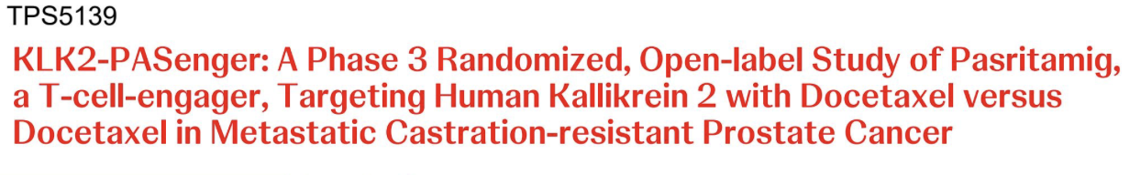
McKay R et al. ASCO 2026;Abstract TPS5139.

Slide 49
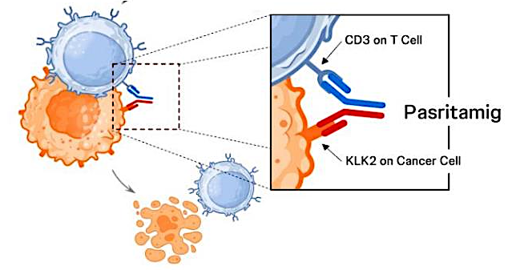
Pasritamig Mechanism of Action
McKay R et al. ASCO 2026;Abstract TPS5139.

Slide 50
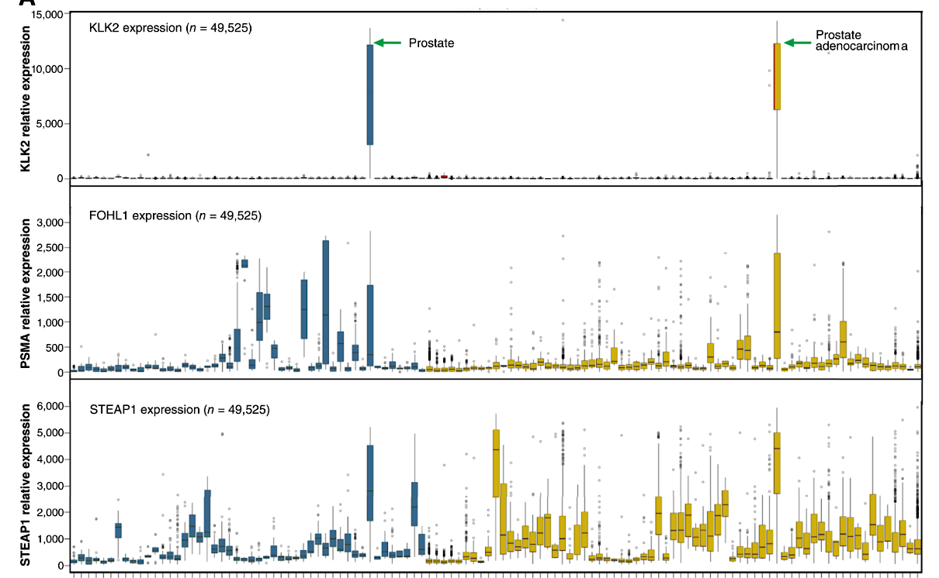
KLK2 Is Highly Expressed on Prostate Cells (Normal and Malignant)
Normal Tissues
Tumor Tissues
Shen F et al. Clin Cancer Res 2025 November 3;31(21):4543-56.

Slide 51
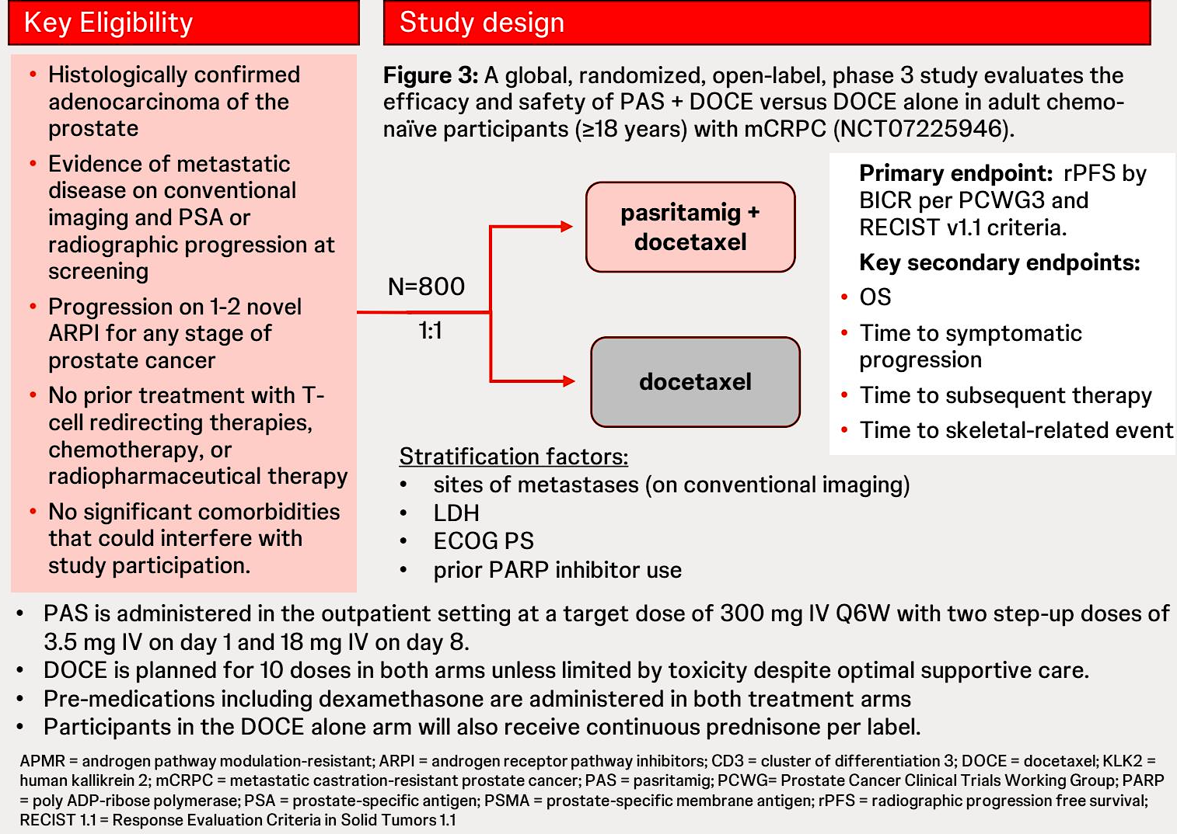
Phase III KLK2-PASenger
McKay R et al. ASCO 2026;Abstract TPS5139.

Slide 52
Agenda
Introduction: Welcome GU Oncology Fellows!
Module 1: Prostate Cancer — Dr Aggarwal
Module 2: Urothelial Bladder Cancer — Dr Galsky
Module 3: Renal Cell Carcinoma — Dr Zhang

Slide 53
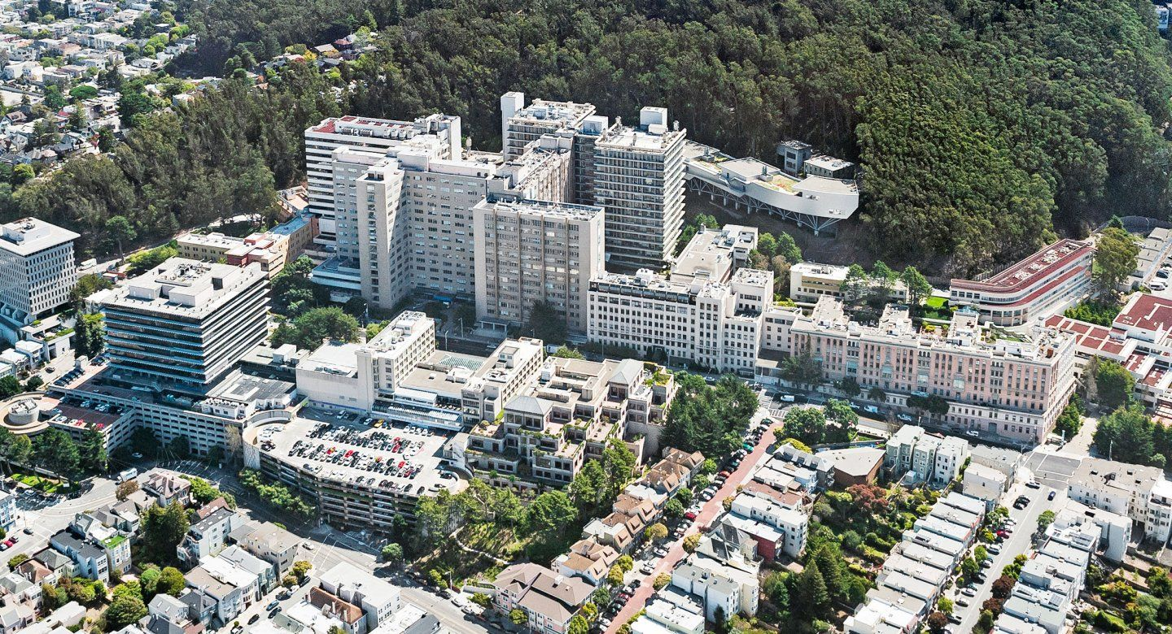

Post-ASCO 2026 Webinar: Prostate Cancer
Rahul Aggarwal MD
Professor of Medicine
University of California San Francisco

Slide 54
Outline
Androgen pathway inhibition in hormone-sensitive prostate cancer
Novel triplets in metastatic hormone sensitive prostate cancer
Updates in PSMA-targeted radioligand therapy

Slide 55
Outline
Androgen pathway inhibition in hormone-sensitive prostate cancer
  Taplin ME et al. Final Analysis of the PROTEUS phase 3 study ASCO 2026; Abstract LBA1
  Freedland S et al. EMBARK: Testosterone recovery to > 250 ng/dL following treatment suspension. ASCO 2026; Abstract 5088
  Choudhury A et al. Phase 2 trial of ADT interruption (A-DREAM / Alliance A032101) ASCO 2026; Abstract 5004
Post-ASCO 2026 Webinar: Prostate Cancer

Slide 56
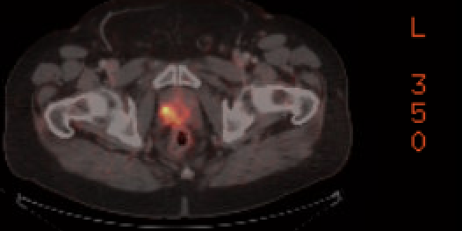
Case #1: High-risk localized prostate cancer
64 y/o M presented with elevated screening PSA of 16.4 ng/mL (prior PSA of 3.3 in 2023)
No significant urinary symptoms
TRUS biopsy with Gleason 4+5 prostate cancer noted in 9/13 cores
Staging PSMA PET with uptake in prostate gland and bilateral pelvic nodes

Slide 57
Case #1: High-risk localized prostate cancer
Patient opted to receive ADT + abiraterone/prednisone for 24 months in combination with radiation to the prostate + pelvis
Future state: Multi-modal treatment with upfront surgery?
  Multimodal treatment with peri-operative ADT + apalutamide with radical prostatectomy (PROTEUS regimen)

Slide 58
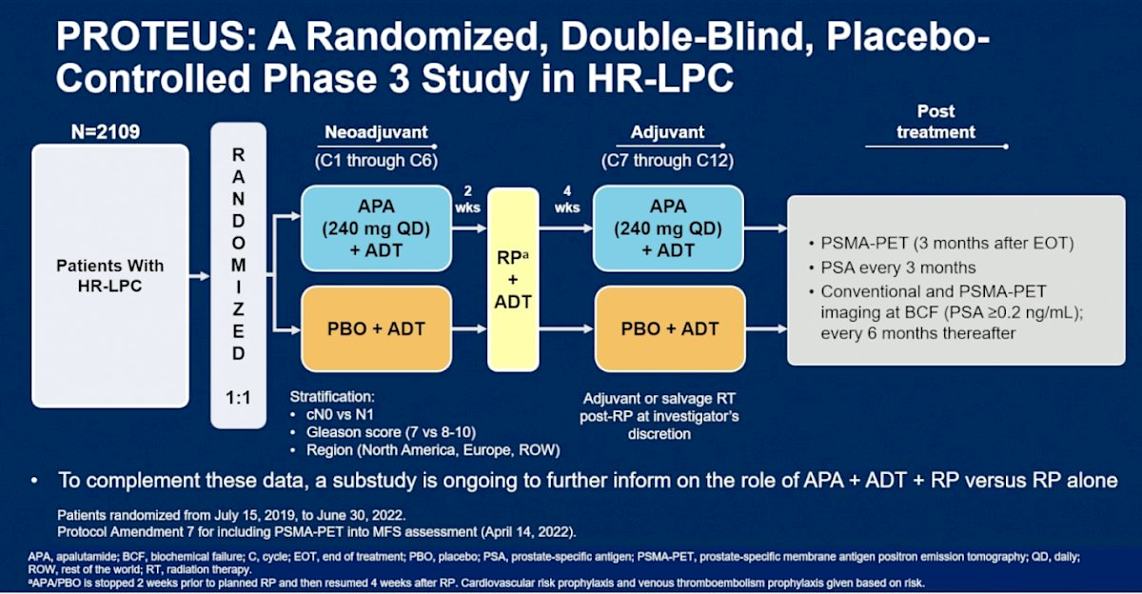
Taplin ME et al. ASCO 2026

Slide 59
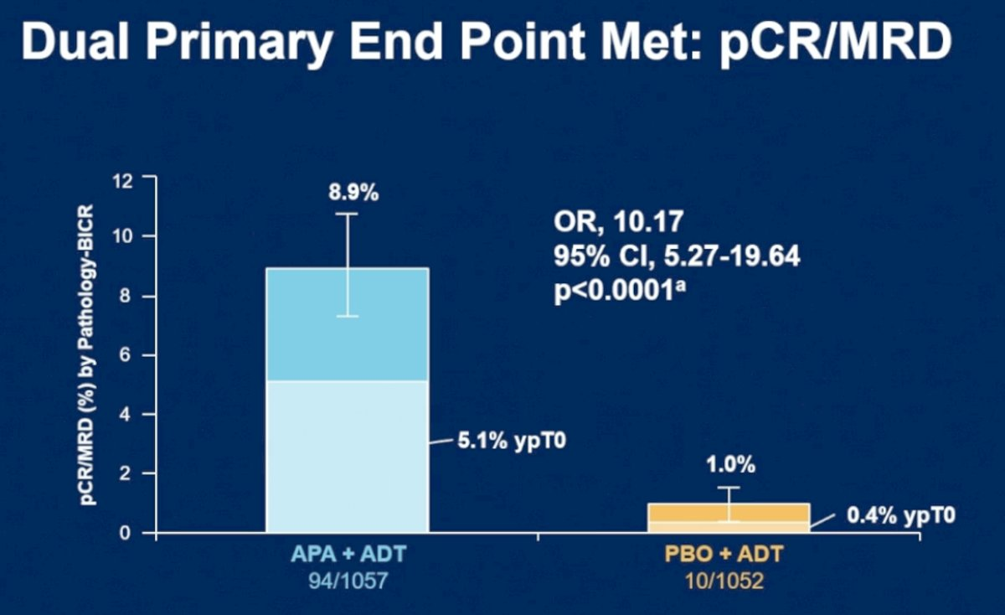
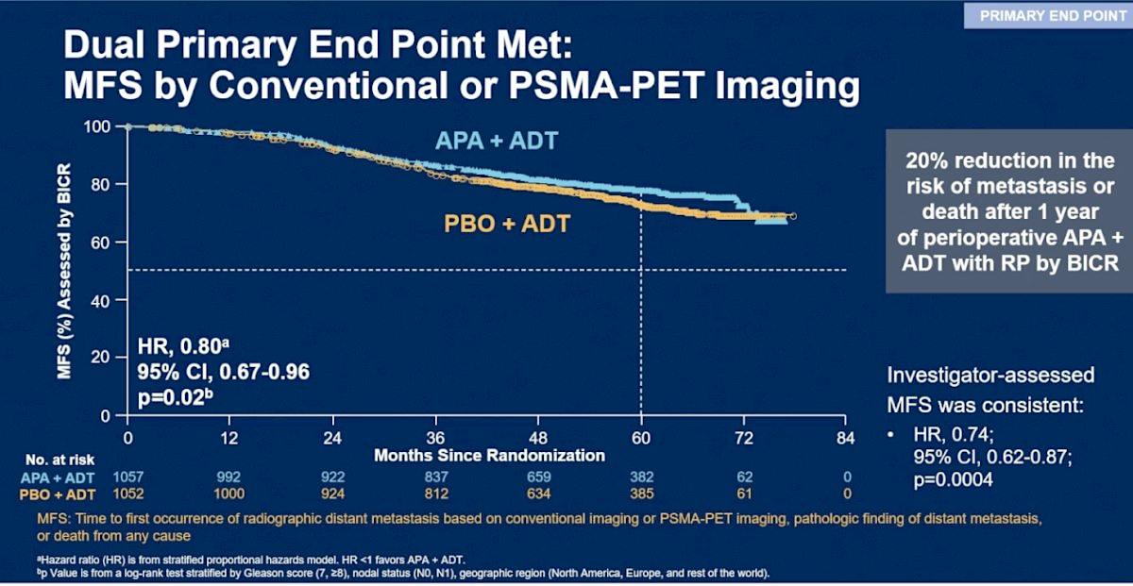
PROTEUS: Primary Endpoints
Taplin ME et al. ASCO 2026

Slide 60
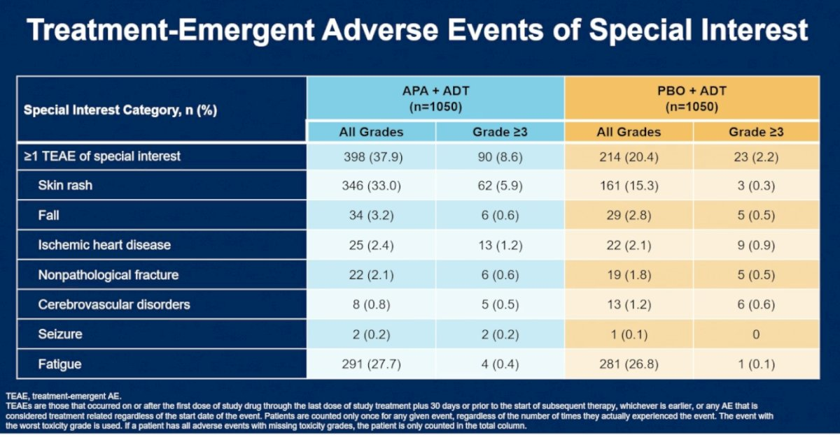
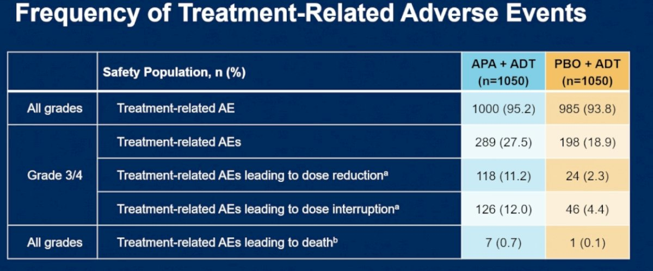
PROTEUS: Safety Results
Taplin ME et al. ASCO 2026

Slide 61
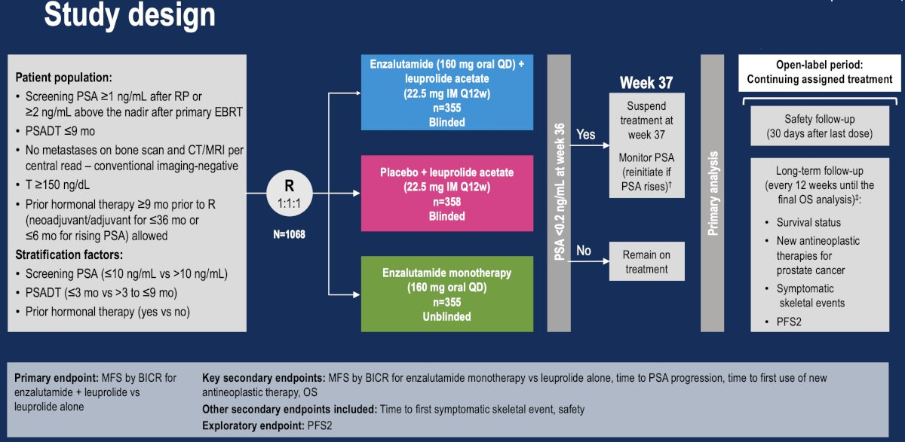
EMBARK: Phase 3 study in biochemical relapse
Freedland S et al. AUA 2023

Slide 62
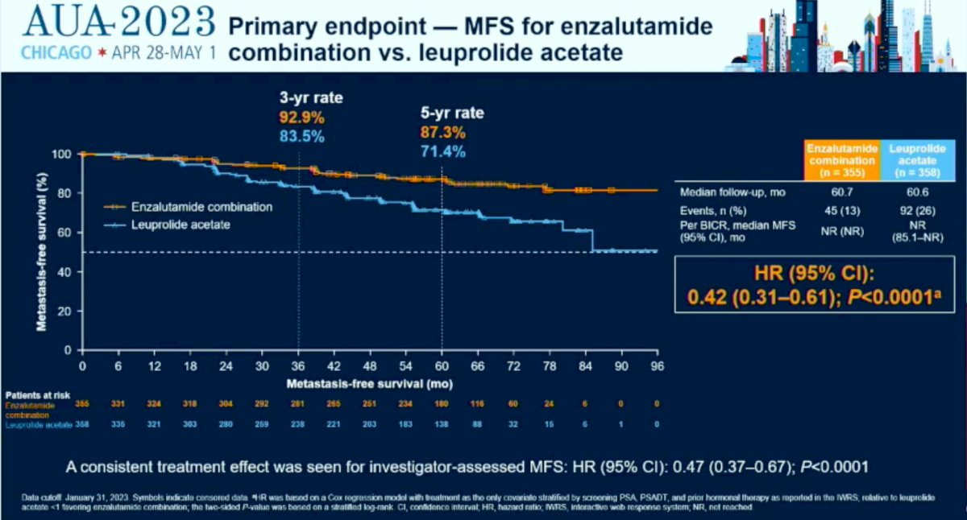
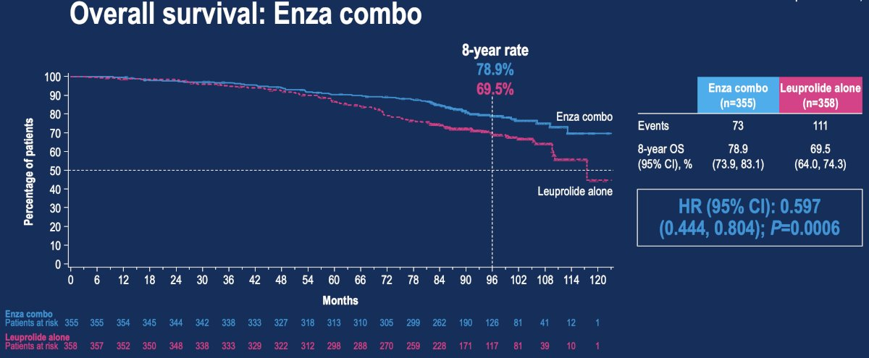
EMBARK: Primary Efficacy Results
Metastasis-free survival
Overall survival
Freedland S et al. AUA 2023

Slide 63
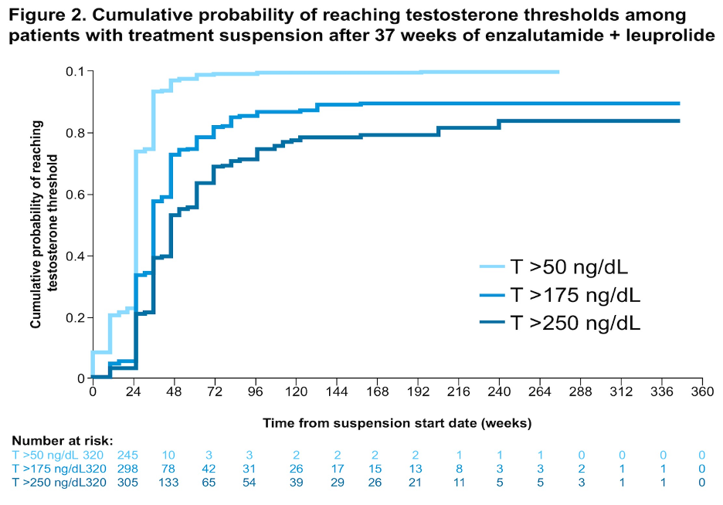
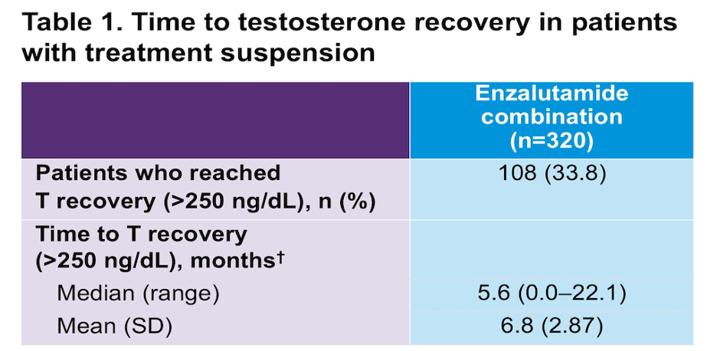
EMBARK: Testosterone recovery following treatment break
90% of patients in combination arm had treatment cessation at 37 weeks
Freedland S et al. ASCO 2026

Slide 64
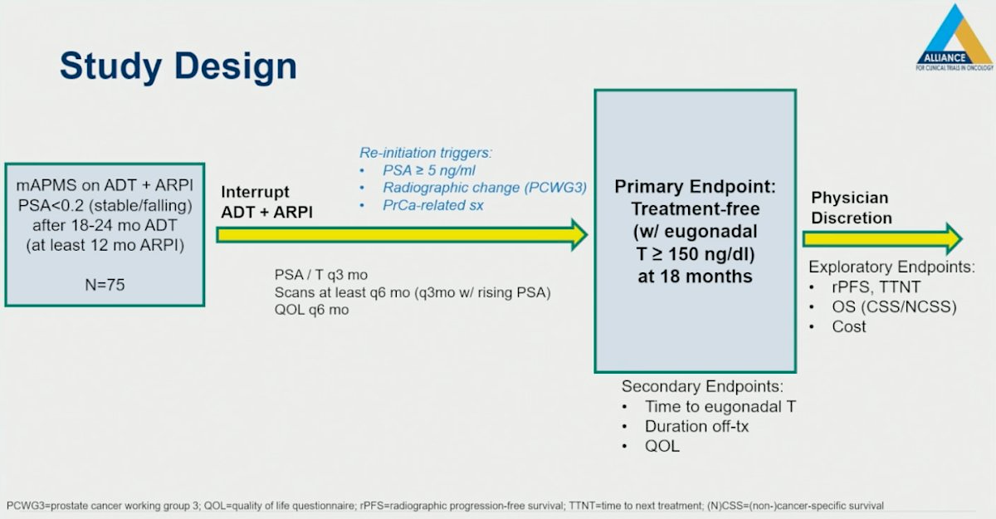
A-DREAM: Treatment interruption in metastatic HSPC with optimal PSA nadir
Choudhury A et al. ASCO 2026

Slide 65
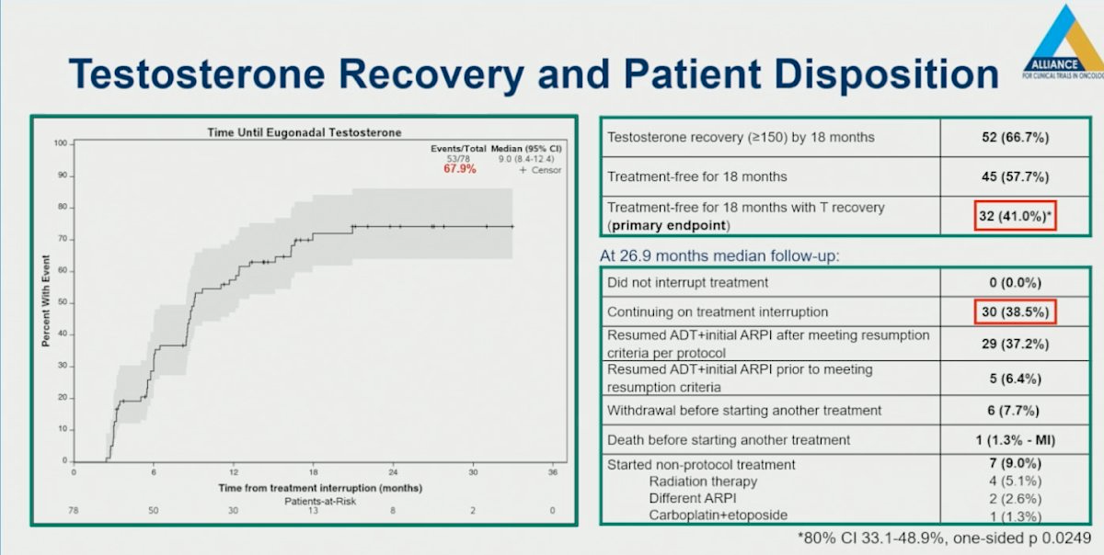
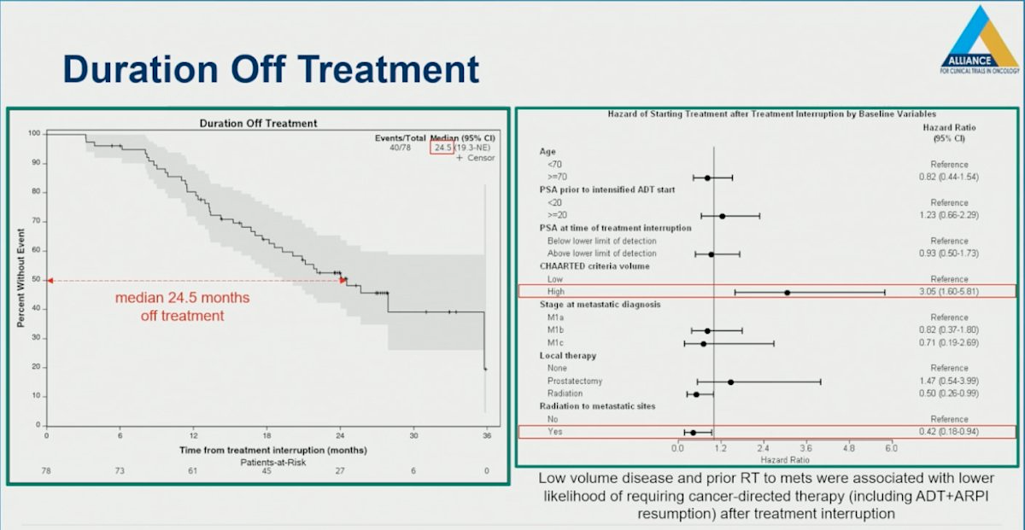
A-DREAM: Treatment interruption in metastatic HSPC with optimal PSA nadir
Choudhury A et al. ASCO 2026

Slide 66
Outline
Androgen pathway inhibition in hormone-sensitive prostate cancer
Novel triplets in metastatic hormone sensitive prostate cancer
Updates in PSMA-targeted radioligand therapy

Slide 67
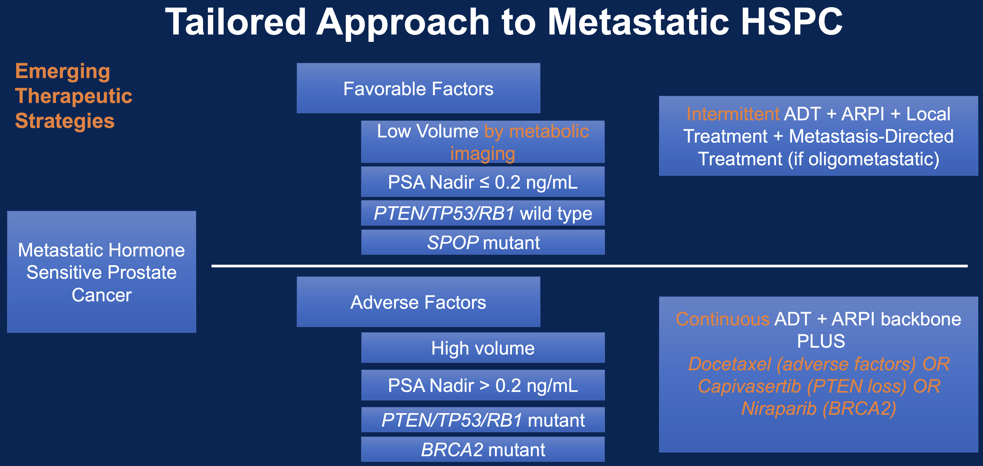

Slide 68
Outline
Novel triplets in metastatic hormone sensitive prostate cancer
  Phase III CAPItello-281 trial in PTEN-deficient mHSPC
  Agarwal N, et al. TALAPRO-3 in mHSPC with HRR gene alterations. ASCO 2026; Abstract LBA5007
  Phase III AMPLITUDE trial of niraparib plus abiraterone/prednisone in BRCA2-altered mHSPC

Slide 69
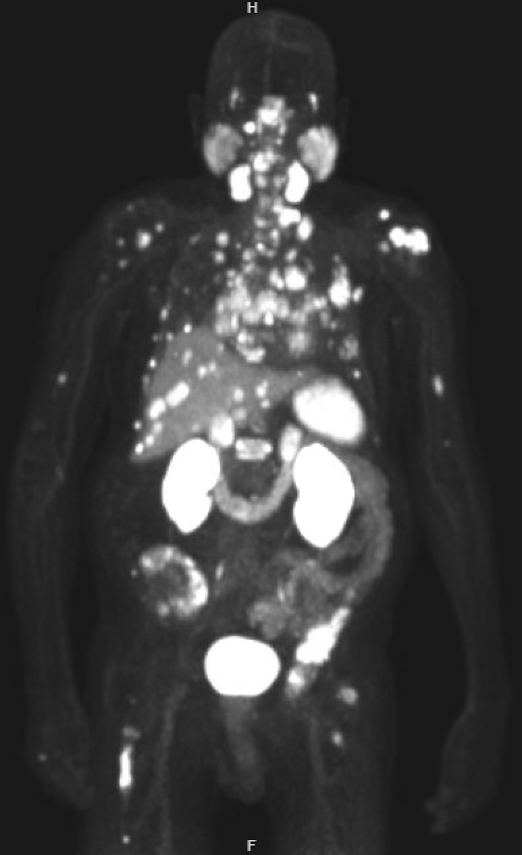
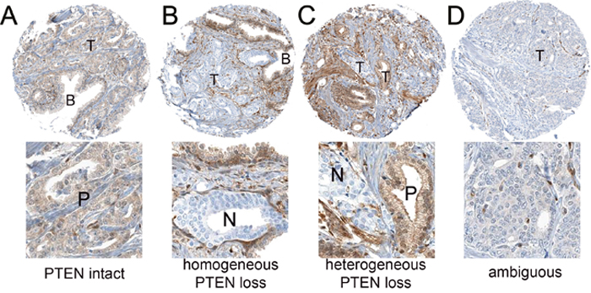
Case #2: PTEN-deficient mHSPC
57 y/o M presented with urinary obstructive symptoms for the past 3 months along with low back pain
TRUS biopsy with Gleason 4+5 prostate cancer noted in 9/13 cores
NGS (UCSF500): PTEN deletion, TP53 mutation, MSS, TMB 2.1 mut/MB
PTEN IHC staining showed loss of expression in 95% of tumor
PSMA PET with multifocal osseous uptake, uptake in primary tumor, hepatic and pulmonary metastases

Slide 70
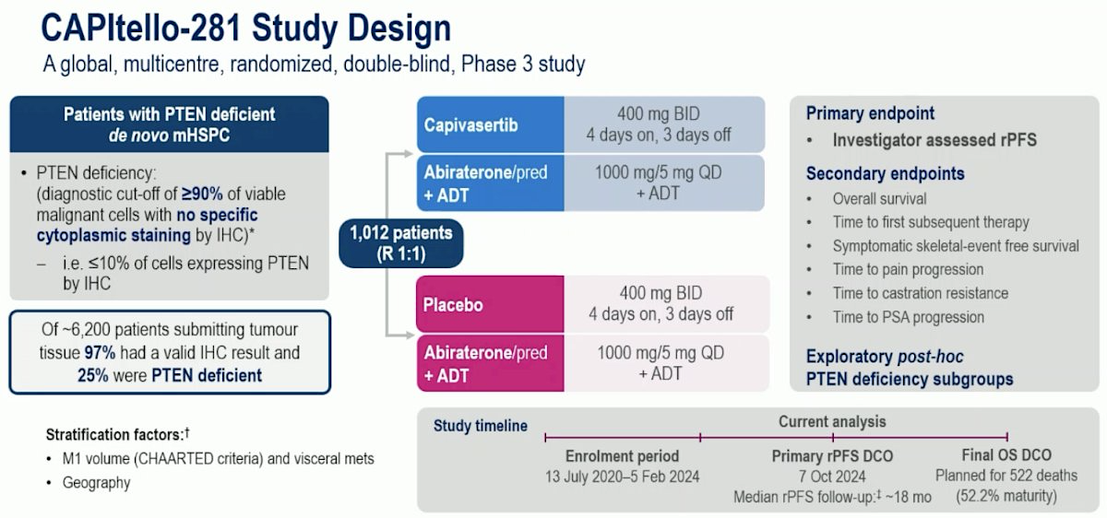
Fizazi K et al. ESMO 2025

Slide 71
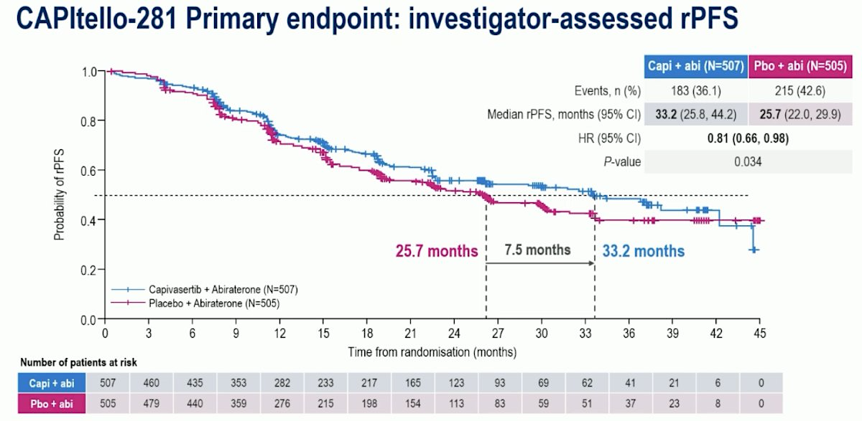
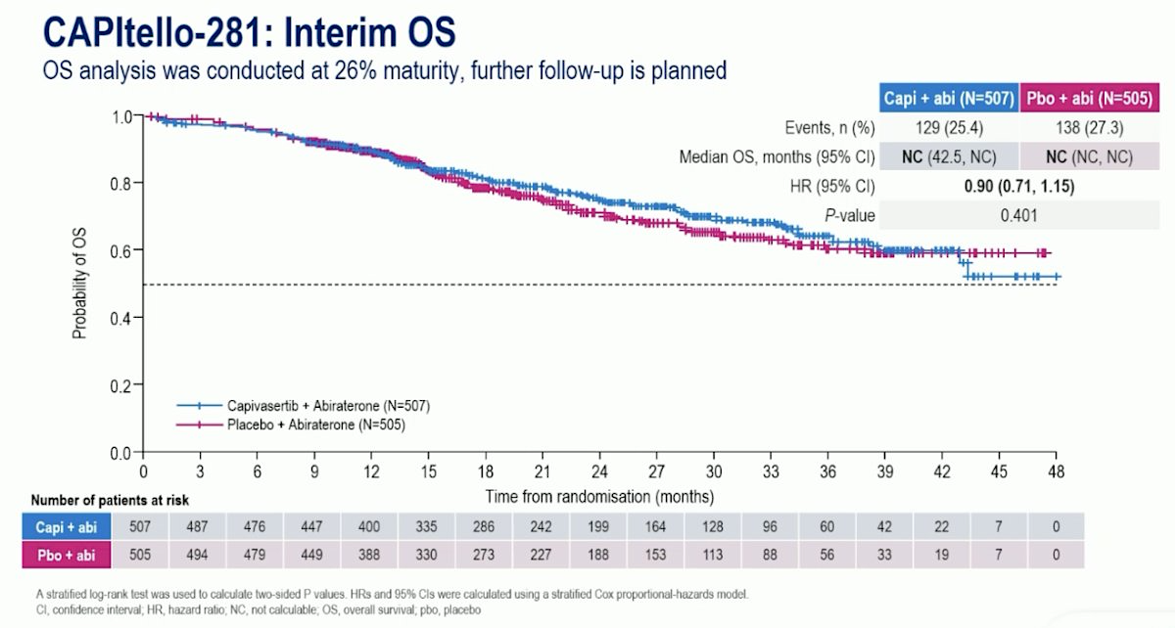
CAPItello-281 Primary Results
Fizazi K et al. ESMO 2025

Slide 72
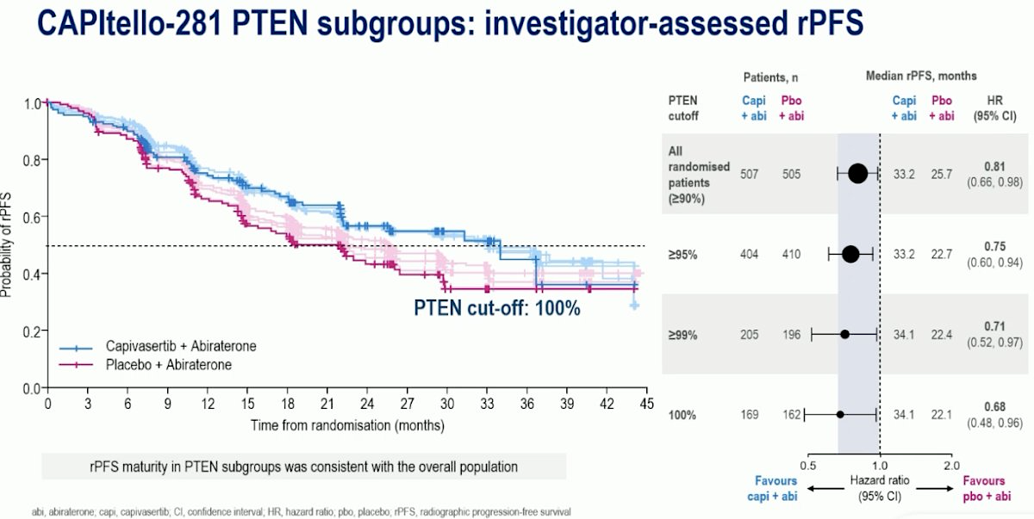
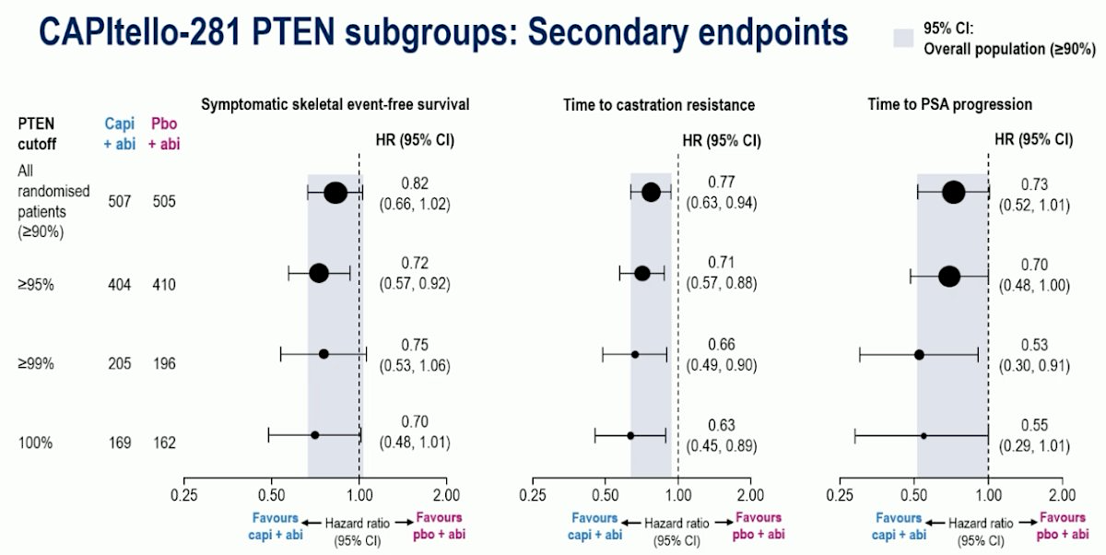
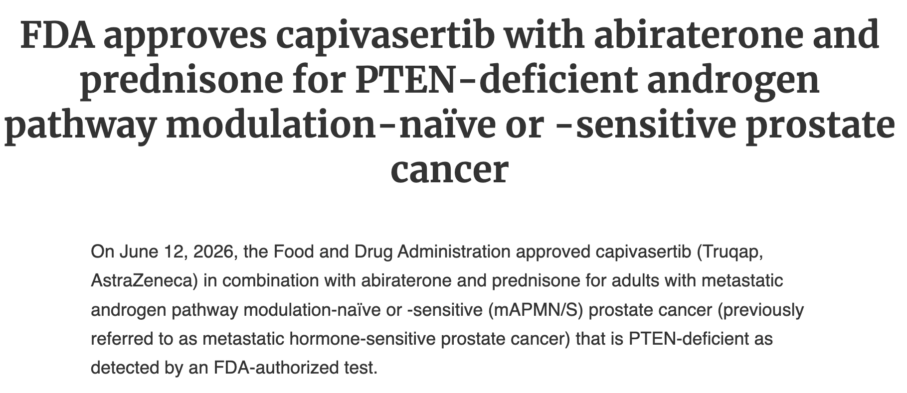
CAPItello-281 Primary Results
Fizazi K et al. ESMO 2025

Slide 73
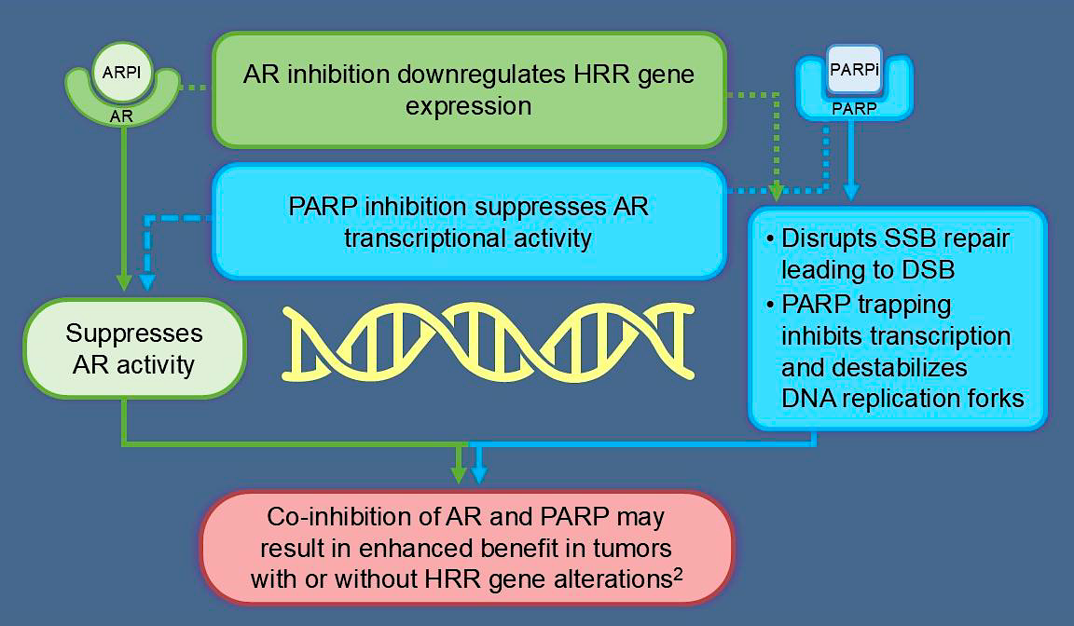
Rationale for the Combination of Androgen Pathway + PARP inhibition in Prostate Cancer

Slide 74
Summary of the Phase 3 Trial Data of ARPI + PARPi in First-line mCRPC
Trial | MAGNITUDE | PROPEL | TALAPRO-2
Experimental arm | Abiraterone + niraparib | Abiraterone + olaparib | Enzalutamide + talazoparib
Sample size (total) | 656 patients | 796 patients | 805 patients
Hazard ratio rPFS (BRCA-mutant) | 0.53 (0.36, 0.79) | 0.23 (0.12, 0.43) | 0.23 (0.10, 0.53)
Hazard ratio OS (BRCA-mutant) | 0.93 (0.72-1.20) | 0.29 (0.14, 0.56) | 0.50 (0.32, 0.78)
FDA Label | BRCA-mutated mCRPC | BRCA-mutated mCRPC | HRR-altered mCRPC

Slide 75
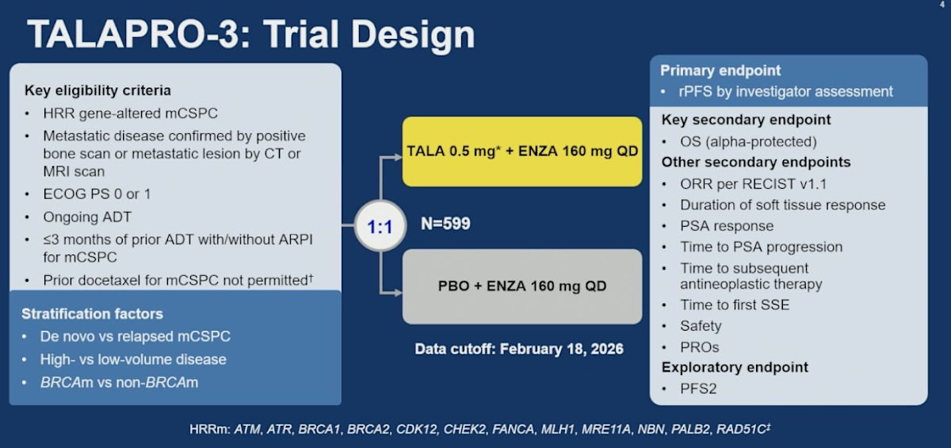
Agarwal N, et al. ASCO 2026

Slide 76
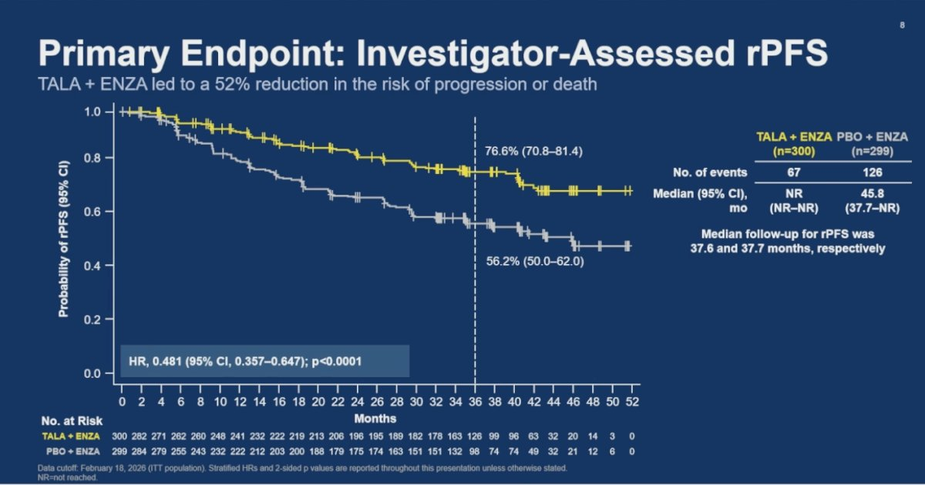
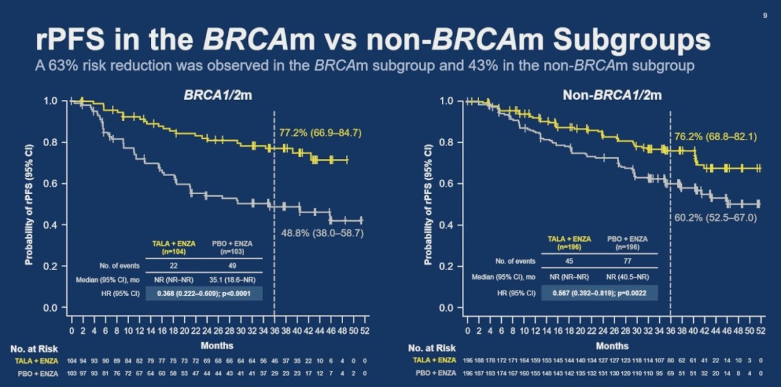
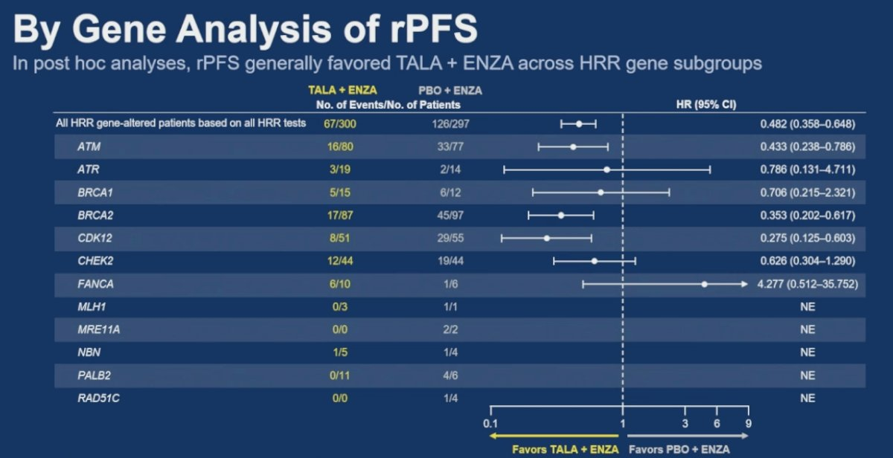
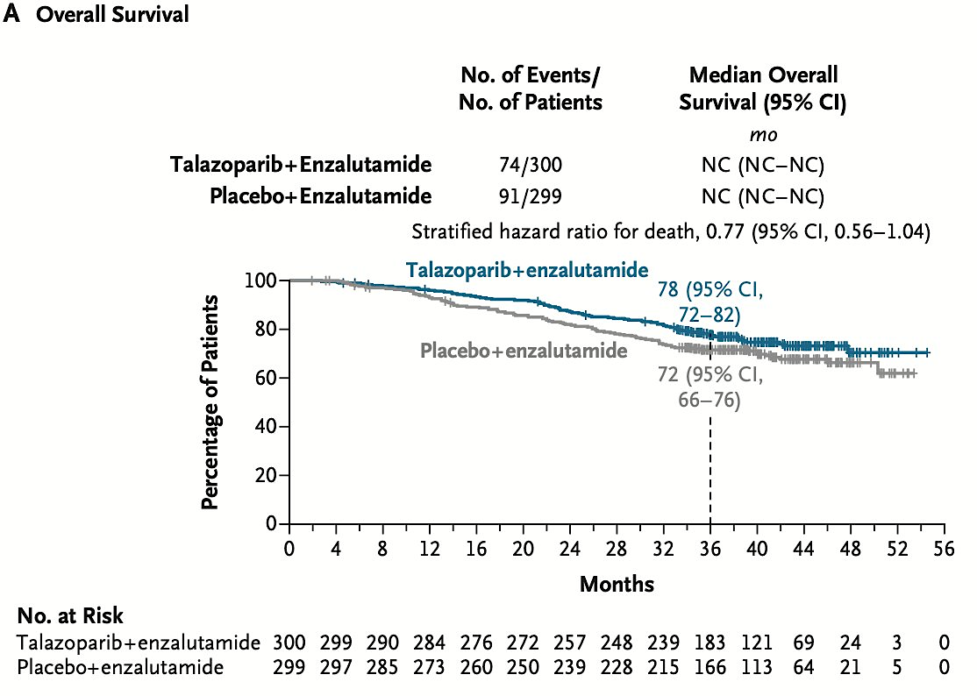
TALAPRO-3: Results
Agarwal N et al. ASCO 2026
Agarwal N et al.
N Engl J Med 2026;
May 30 (online ahead
of print).

Slide 77
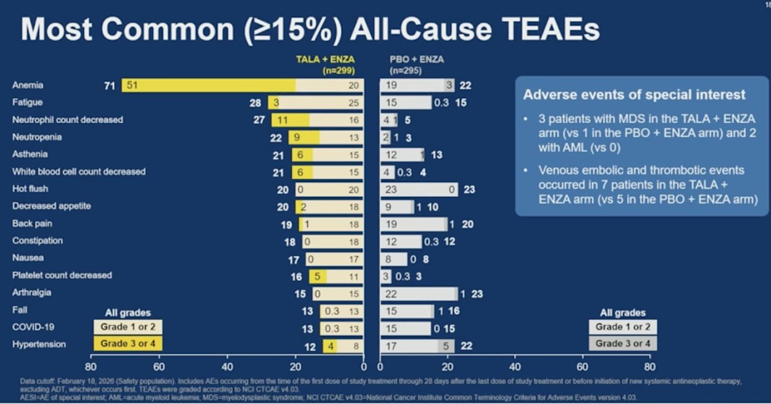
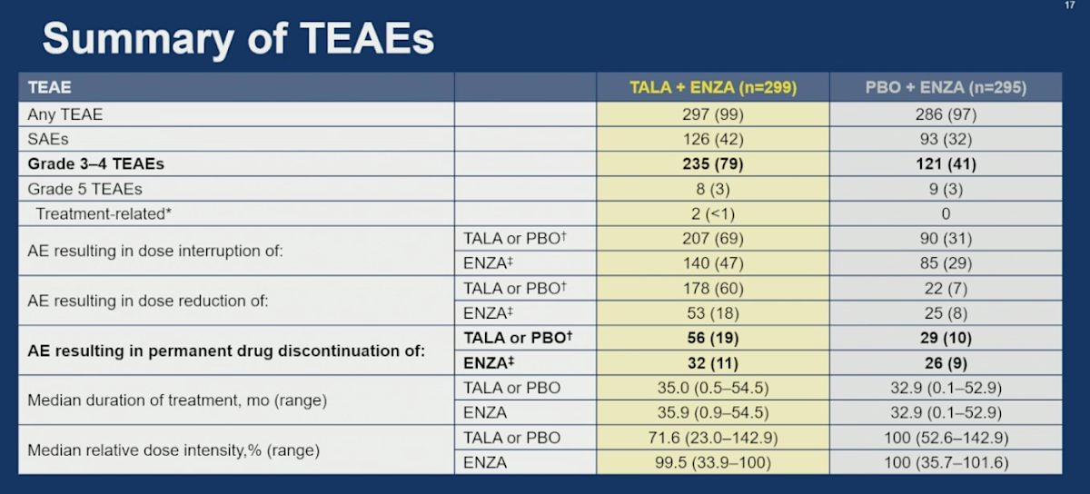
TALAPRO-3: Results
Agarwal N et al. ASCO 2026

Slide 78
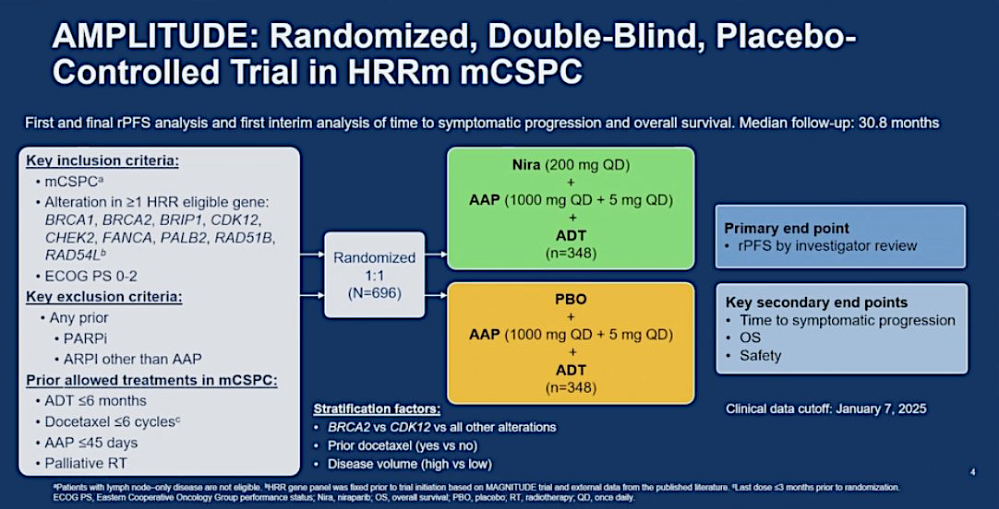
Attard G et al. ASCO 2025

Slide 79
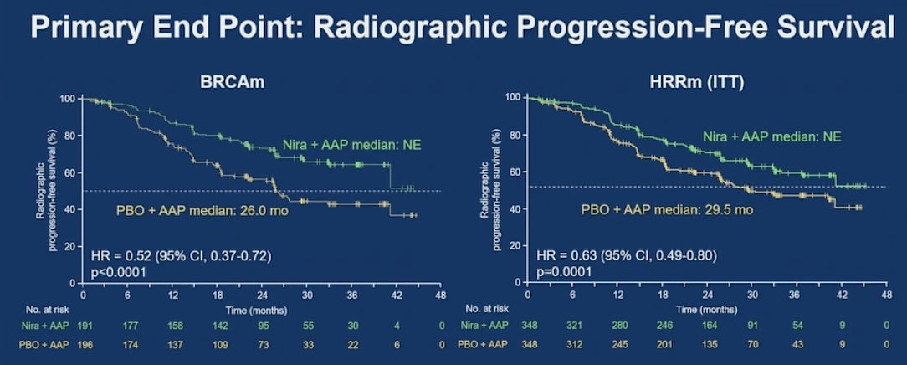
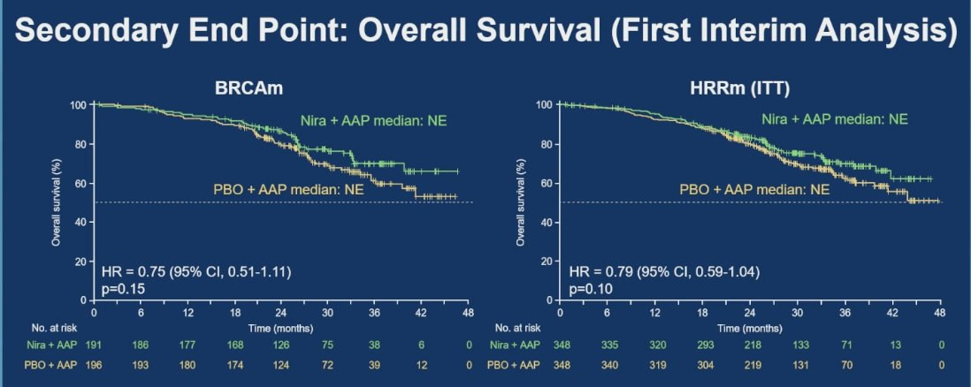
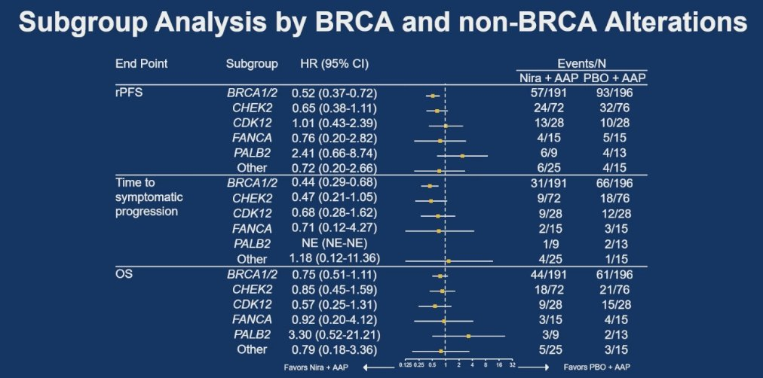
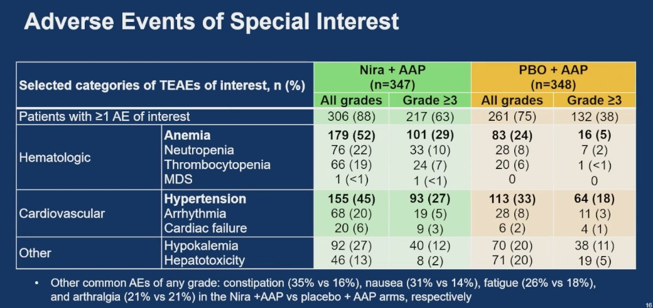
AMPLITUDE Primary Results
Attard G et al. ASCO 2025

Slide 80
Outline
Androgen pathway inhibition in hormone-sensitive prostate cancer
Novel triplets in metastatic hormone sensitive prostate cancer
Updates in PSMA-targeted radioligand therapy

Slide 81
Outline
Updates in PSMA-targeted radioligand therapy
  Saad F et al. Subgroup analyses from PSMAddition ASCO 2026; Abstract 5020
  Emmett L et al. AcTION: Phase 1 study of [225Ac]-Ac-PSMA-617 in mCRPC ASCO 2026; Abstract 5010

Slide 82
Case #3: Taxane-naïve mCRPC
52 y/o M presented in 2024 with urinary obstruction, hydronephrosis
12/2024: TURP/TURBT with Gleason 5+5 prostate adenocarcinoma, TP53 mutation, MSS, TMB low
PSA 50
PSMA PET with extensive bulky adenopathy, bulky primary tumor
Received ADT + abi/pred + docetaxel triplet for mHSPC
Nadir PSA 0.7, subsequent transition to mCRPC after 10 months
CT-guided biopsy of RP node: Prostate adenocarcinoma, + NKX.3, negative NE markers
Starts Lu-PSMA-617 in March 2026

Slide 83
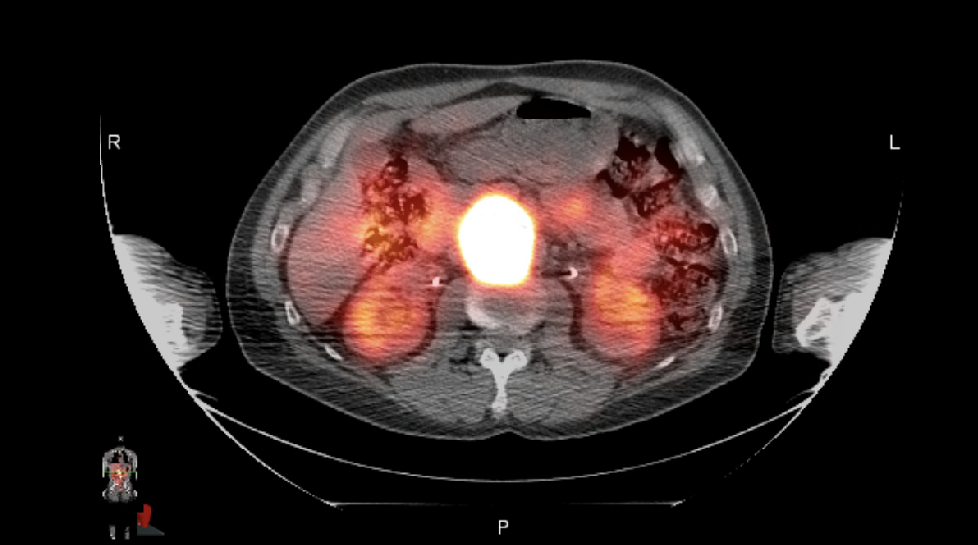
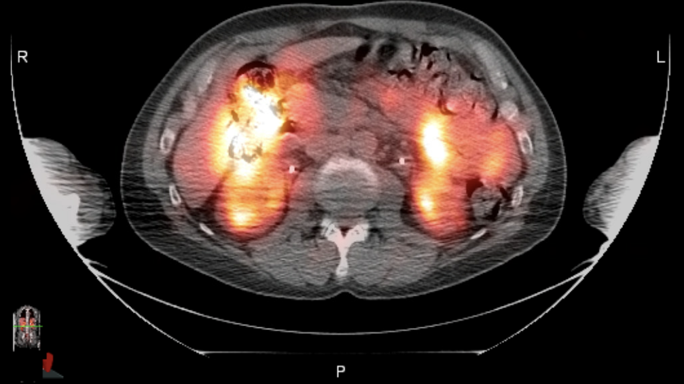
Case #3: Taxane-naïve mCRPC
Received two doses of Lu-PSMA-617 to date in March and May 2026 with complete PSA and radiographic response by SPECT/CT imaging
Currently on treatment break with serial assessment of PSA and cross-sectional imaging every 12 weeks
Pre-treatment
PET bulky RP node
Following cycle 2

Slide 84
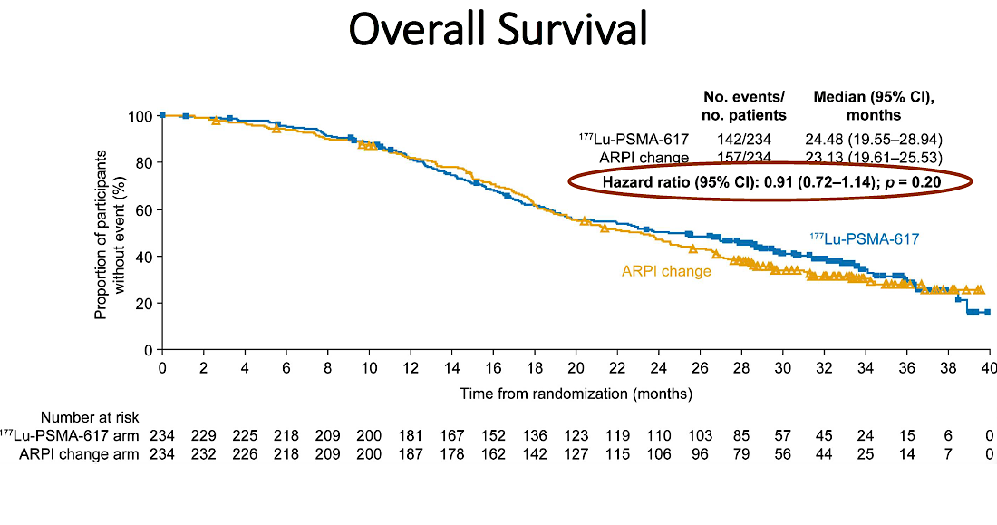
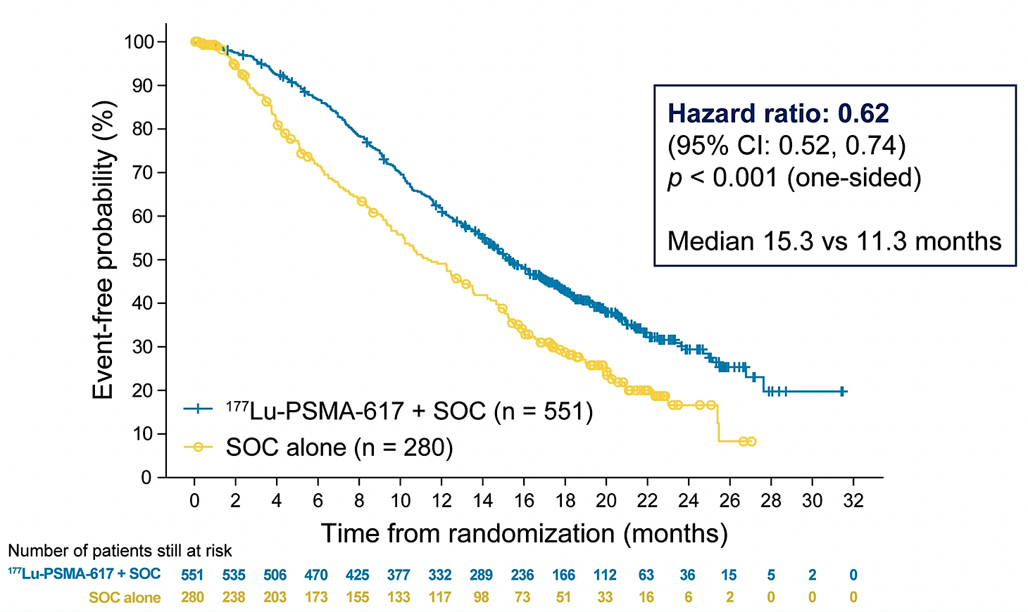
Lu-PSMA-617 in pre- and post-taxane mCRPC
Pre-taxane: PSMAfore
Post-taxane: VISION
57% of patients in control arm crossed over to receive Lu-PSMA-617
Cross-over adjusted (IPCW) hazard ratio for OS = 0.59 (0.38, 0.91)
Fizazi K et al. Ann Oncol 2025; Morris M et al. ASCO 2021

Slide 85
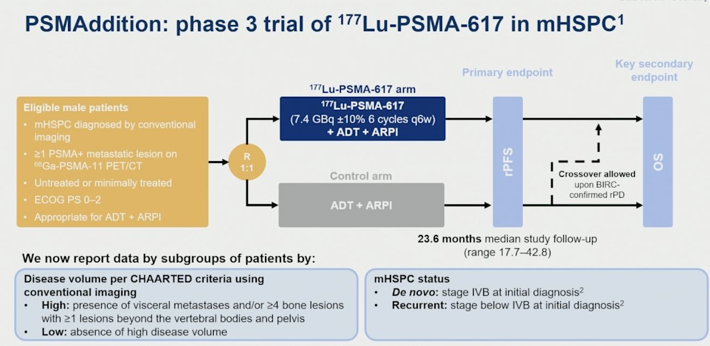
PSMAddition Subgroup Analyses
Saad F et al. ASCO 2026

Slide 86
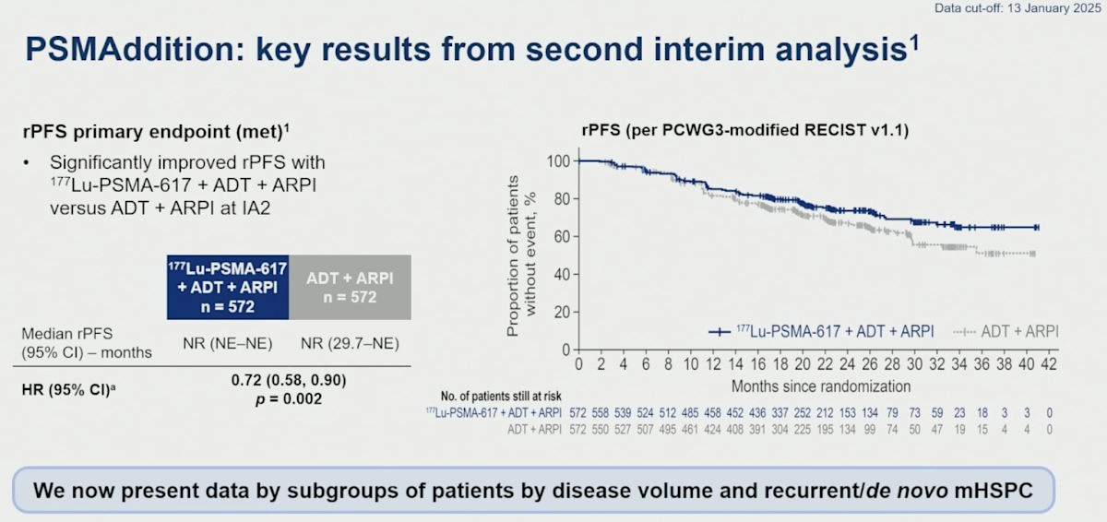
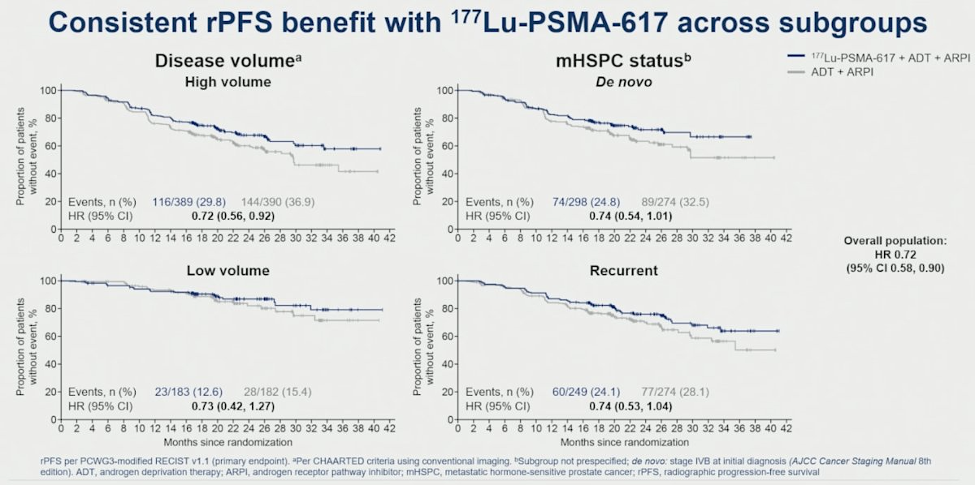
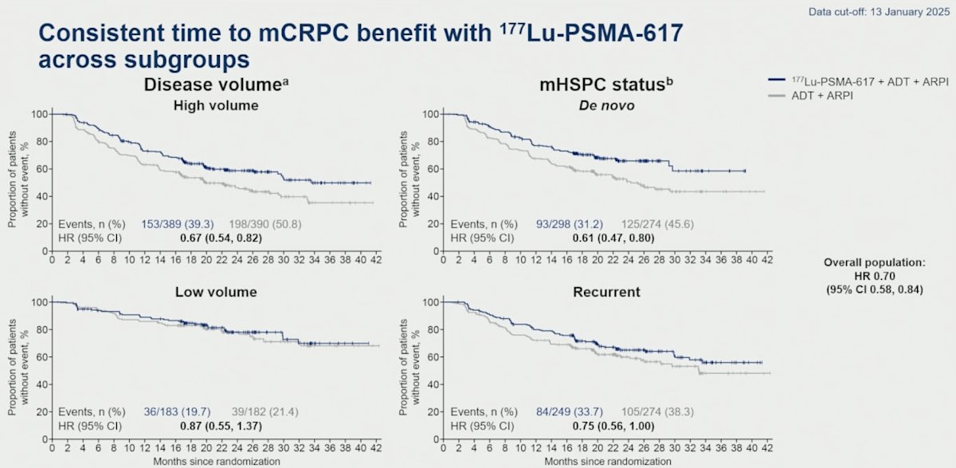
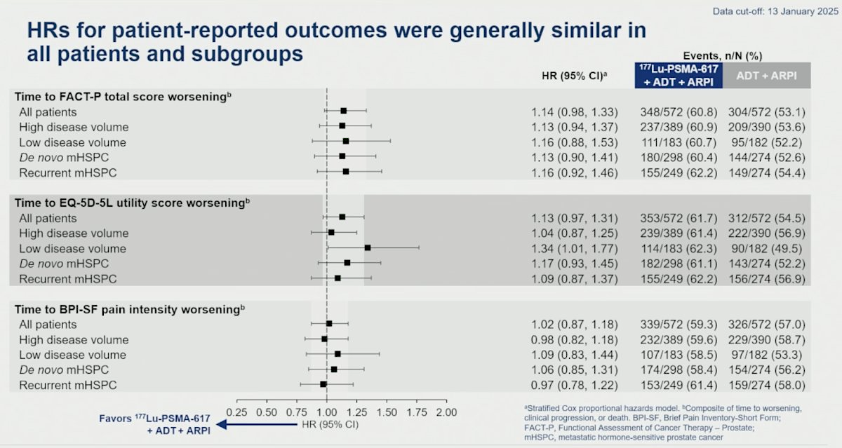
PSMAddition Subgroup Analyses

Slide 87


AcTION Phase 1 Trial of 225Ac-PSMA-617
Emmett L et al. ASCO 2026

Slide 88




AcTION Phase 1 Trial of 225Ac-PSMA-617

Slide 89
Agenda
Introduction: Welcome GU Oncology Fellows!
Module 1: Prostate Cancer — Dr Aggarwal
Module 2: Urothelial Bladder Cancer — Dr Galsky
Module 3: Renal Cell Carcinoma — Dr Zhang

Slide 90

Post ASCO 2026: Urothelial Cancer
Matthew D. Galsky, MD FASCO
Lillian and Henry Stratton Professor of Medicine
Icahn School of Medicine at Mount Sinai
Director, Genitourinary Medical Oncology
Deputy Director
The Tisch Cancer Center at Mount Sinai

Slide 91
Phase 3 Trials of BCG + IO in BCG-Naïve Patients With NMIBC
POTOMAC
ALBAN
CREST
Eligibility Criteria
High-grade Ta, T1 and/or CIS
Multiple and recurrent and large with largest tumor ≥ 3 cm
Eligibility Criteria
High-grade Ta, T1 and/or CIS
Eligibility Criteria
High-grade Ta, T1 and/or CIS
Treatment
Durvalumab 1500 mg IV Q4Wk x 13 cycles
Treatment
Atezolizumab 1200 mg IV Q3Wk x 18 cycles
Treatment
Sasanlimab 300 mg SC Q4Wk x 25 cycles
1. Roupret et al. Ann Oncol; 2025. 2. De Santis et al. Lancet. 2025. 3. Shore et al. Nat Med. 2025

Slide 92
Phase 3 Trials of BCG + IO in BCG-Naïve Patients With NMIBC
POTOMAC
ALBAN
CREST
Eligibility Criteria
High-grade Ta, T1 and/or CIS
Multiple and recurrent and large with largest tumor ≥ 3 cm
Eligibility Criteria
High-grade Ta, T1 and/or CIS
Eligibility Criteria
High-grade Ta, T1 and/or CIS
Met Primary DFS Endpoint
**US FDA Approval**
Didn’t Meet Primary EFS Endpoint
Met Primary EFS Endpoint
Treatment
Durvalumab 1500 mg IV Q4Wk x 13 cycles
Treatment
Atezolizumab 1200 mg IV Q3Wk x 18 cycles
Treatment
Sasanlimab 300 mg SC Q4Wk x 25 cycles
1. Roupret et al. Ann Oncol; 2025. 2. De Santis et al. Lancet. 2025. 3. Shore et al. Nat Med. 2025

Slide 93


POTOMAC: OS data and QoL
De Santis M et al. ASCO 2026: Abstract 4624

Slide 94



POTOMAC: OS data and QoL
De Santis M et al. ASCO 2026: Abstract 4624

Slide 95
TAR-200 in Bladder Cancer
TAR-200 ± CET
TAR-210

Slide 96
Phase 2b SunRISe-1 Study: Cohort 2 BCG-Unresponsive
HR NMIBC CIS ± Papillary Disease
NCT04640623
Population:
Aged ≥18 years
Histologically confirmed
HR NMIBC CIS (with or without papillary disease)
ECOG PS of 0-2
Persistent or recurrent disease within 12 months of completion of BCG
Unresponsive to BCG^{1,2} and not receiving RC
TAR-200 + Cetrelimab^{b}
Cohort 1 (N=53)^{c}
Cohort 1 was closed
TAR-200 dosing:
Q3W (indwelling) for the first 24 weeks;
then Q12W through
Week 96
Cohorts 1-3:
Primary end point
Overall CR rate
Key secondary end points
Duration of response
Overall survival
Safety
Tolerability
HRQoL
TAR-200 Monotherapy
Cohort 2 (N=85)
Enrollment completed
R
Cetrelimab^{b} Monotherapy
Cohort 3 (N=28)
Cohort 3 was closed
Population:
Papillary-only HR NMIBC
(no CIS)ª
TAR-200 Monotherapy
Cohort 4 (N=52)
Enrollment completed
Cohort 4:
Primary end point
DFS
Daneshmand, S et al. TAR-200 for Bacillus Calmette-Guérin–Unresponsive High-Risk Non–Muscle-Invasive Bladder Cancer: Results From the Phase IIb SunRISe-1 Study. J Clin Oncol 43, 3578-3588(2025).

Slide 97


TAR-200 Monotherapy in BCG-Unresponsive HR NMIBC CIS ± Papillary Disease
Daneshmand, S et al. TAR-200 for Bacillus Calmette-Guérin–Unresponsive High-Risk Non–Muscle-Invasive Bladder Cancer: Results From the Phase IIb SunRISe-1 Study. J Clin Oncol 43, 3578-3588(2025).

Slide 98
TAR-210 erdafitinib intravesical delivery first-in-human phase 1 trial
HR-NMIBC (cohort 1)
Recurrent, high-grade Ta/T1, papillary only, no CIS
BCG-experienced/unresponsive and not undergoing RC
TURBT with complete resection of all visible disease prior to treatment
Part 1: dose escalation
Placement every 3 months
BOIN
TAR-210-D
≈ 4 mg/day
Molecular eligibility
FGFR alterations: flexible molecular eligibility strategy used
  Local or central fresh/archival tissue-based testing by NGS
  or PCR or
  Central urine cell-free DNA
  NGS testing
TAR-210-B
≈ 2 mg/day
IR NMIBC (cohort 3)
Recurrent, history of low-grade only Ta/T1 disease
Visible target lesions prior to treatment (chemoablation design)
Part 2: dose expansion
Expansion of both dose levels
Response assessed every 3 months with continued treatment for up to 1 year if recurrence free (cohort 1) or CR (cohort 3)
Interim results:
Cohort 1
Interim results:
Cohort 3
NCT06319820
NCT06919965
Phase 3 MoonRISe-1 underway: TAR-210 vs IV chemo in FGFR-altered IR NMIBC
Phase 3 MoonRISe-3 underway: TAR-210 vs IV chemo in BCG-treated, FGFR-altered Papillary only HR NMIBC
BOIN, Bayesian Optimal Interval; CR, complete response; HR, high risk; IR, intermediate-risk; NGS, next-generation sequencing; NMIBC, nonmuscle-invasive bladder cancer;
PCR, polymerase chain reaction; RC, radical cystectomy.
1. Liu S and Yuan Y. J R Stat Soc Ser C Appl Stat. 2015;64:507–523. 2. Yuan Y et al. Clin Cancer Res. 2016;22:4291–4301. 3. Vilaseca A et al. Presentation at the American Urological Association Annual Meeting; May 3–6, 2024; San Antonio, TX. Abstract 1343

Slide 99



Evolution of Systemic Therapy for MIBC
2003
2012
2021
2024
2025
Perioperative
EV plus Pembrolizumab
Neoadjuvant MVAC
Concurrent chemoradiation
Adjuvant Nivolumab
Neoadjuvant
GC plus durvalumab
First regimen to surpass cisplatin-based chemotherapy
Survival improvement
Locoregional disease-free survival improvement
Disease free survival improvement
Survival improvement
New Standard of Care
Grossman, NEJM, 2003; James, NEJM, 2012; Bajorin, NEJM, 2021; Powles NEJM, 2024; Vulsteke, NEJM, 2026; Galsky, ASCO GU, 2026

Slide 100
IMvigor 011 Phase 3 Trial
Powles T et al. N Engl J Med. 2025 Oct 20.

Slide 101

IMvigor 011 Phase 3 Trial
Powles T et al. N Engl J Med. 2025 Oct 20.

Slide 102


IMvigor 011 Phase 3 Trial: PROs
Bellmunt J et al. ASCO 2026;Abstract 4627

Slide 103
Contemporary perioperative trials in cisplatin-ineligible patients
Keynote-905/EV 303
VOLGA
(NCT03924895) (N = 857)
(NCT04960709) (N = 830)
Treatment
Pembro → RC → Pembro (Arm A)
RC Alone (Arm B)
EVP → RC → EVP (Arm C)
Treatment
Durva + Treme + EV → RC → Durva + Treme (Arm A)
Durva + EV → RC → Durva (Arm B) vs
No systemic therapy → RC (Arm C)
Key Eligibility Criteria
Patients with MIBC who are cisplatin ineligible or refusant
Key Eligibility Criteria
Muscle invasive urothelial carcinoma; cisplatin ineligible or refusant
Primary & Secondary Endpoints
Primary: EFS up to 7.7 yrs (Arms B+C)
Secondary: EFS up to 7.7 yrs (Arms A+B), OS up to 7.7 yrs (Arms B+C)
Primary & Secondary Endpoints
Primary: Efficacy of durva + treme + EV relative to surgery alone (pCR and EFS)
Secondary: pCR at time of cystectomy in Arm B vs Arm C
MET PRIMARY ENDPOINT
PRESS RELEASE: POSITIVE STUDY

Slide 104
KEYNOTE 905
Allocation to this treatment arm stopped November 2022
Key Eligibility Criteria
Adult with MIBC
Clinical stage T2-T4aN0M0 or T1-T4aN1M0 by central assessment
≥ 50% urothelial histology
Cisplatin-ineligible per Galsky criteria or cisplatin-declining
ECOG PS 0-2
Pembrolizumab (200 mg)
IV Q3W 3 cycles
Pembrolizumab (200 mg)
IV Q3W 3 cycles
R
Observation
N = 344, 1:1
n = 174
RC + PLND
Enfortumab vedotin (1.25 mg/kg)
D1 and D8 IV Q3W 3 Cycles
+
Pembrolizumab (200 mg)
IV Q3W 3 Cycles
Enfortumab vedotin (1.25 mg/kg)
D1 and D8 IV Q3W 6 Cycles
+
Pembrolizumab (200 mg)
IV Q3W 3 Cycles
n = 170
Stratification Factors
Cisplatin ineligibility (ineligible vs. eligible but declining)
Clinical stage (T2N0 vs T3/T4aN0 vs T1-4aN1)
Region (US vs EU vs World)
Primary Endpoint
EFS by BICR
Secondary Endpoints
OS, pCR; pT0N0 by central pathologist review
Other Endpoints
Safety
Vulsteke C, et al. N Engl J Med. 2026.

Slide 105


KEYNOTE 905
Vulsteke C, et al. N Engl J Med. 2026.

Slide 106
KEYNOTE 905
Change From Baseline Over Time in EQ-5D-5L VAS
EV + pembro
Control
QoL
Improvement
15
15
10
10
5
5
Mean Score Change From Baseline (95% CI)
Mean Score Change From Baseline (95% CI)
0
0
-5
-5
-10
-10
QoL
Deterioration
-15
-15
Pre-
neoadj
(Wk 0)
Wk
4
Wk
7
Wk
10
Wk
9
Wk
12
Wk
18
Wk
30
Wk
42
Wk
54
Wk
66
Wk
78
Wk
90
Wk
102
Pre-surg
(Wk 0)
Wk
9
Wk
18
Wk
30
Wk
42
Wk
54
Wk
66
Wk
78
Wk
90
Wk
102
Pre-surg
Post-surg
Post-surg
No. of pts
156
135
126
137
122
84
102
91
82
78
53
46
43
33
105
100
75
66
55
45
33
22
22
17
O'Donnell P, ASCO 2026.

Slide 107
Contemporary perioperative trials in cisplatin-eligible patients
NIAGARA
KeyNote-866
KeyNote-B15
Energize
(NCT03732677)
(NCT03924856)
(NCT04700124)
(NCT03661320)
(N = 1063)
(N = 907)
(N = 784)
(N = 861)
Durvalumab + GemCis → RC → Durvalumab
GemCis → RC
Pembro + GemCis → RC → Pembro
GemCis → RC
EVP → RC → EVP
GemCis → RC
GemCis → RC, Nivo + GemCis → RC → Nivo, Nivo + GemCis + Linro → RC → Nivo + Linro
Key Inclusion Criteria
MIBC/Immuno- and Chemotherapy Treatment-Naïve
Key Inclusion Criteria
UC/MIBC and RC plus PLND eligible
Key Inclusion Criteria
UC/MIBC and RC plus PLND eligible
Key Inclusion Criteria
MIBC/Treatment-Naive
Primary & Secondary Endpoints
Primary: pCR up to 6 mos, EFS up to 48 mos
Secondary: <P2 at time of cystectomy, EFS at 24 mos
Primary & Secondary Endpoints
Primary: EFS up to 60 mos
Secondary: pCR and OS
up to 72 mos
Primary & Secondary Endpoints
Primary: EFS up to 48 mos
Secondary: pCR up to 47 mos,
OS up to 68 mos
Primary & Secondary Endpoints
Primary: pCR (43 mos), EFS (51 mos)
Secondary: OS (60 mos),
AEs and SAEs
MET PRIMARY ENDPOINT
ACTIVE, NOT RECRUITING
MET PRIMARY ENDPOINT
ACTIVE, NOT RECRUITING

Slide 108
NIAGARA
Perioperative
Neoadjuvant
4 cycles
Adjuvant
8 cycles
Study Population
Cisplatin-eligible MIBC (cT2-T4aN0/1M0)
UC or UC with divergent differentiation or histologic subtypes
Evaluated and confirmed for RC
CrCl of ≥ 40 mL/min
n=533
Durvalumab 1500 mg IV Q3W
Gemcitabine + Cisplatin
Durvalumab
1500 mg IV Q4W
Primary Endpoints
EFS pCR
Key Secondary Endpoints
OS Safety
R
1:1
Radical cystectomy
Gemcitabine + Cisplatin
No Treatment
n=530
Stratification Factors
Clinical tumor stage (T2N0 vs >T2N0)
Renal function (CrCl ≥ 60 mL/min vs ≥ 40 to < 60 mL/min)
PD-L1 status (high vs low/negative expression)
Gemcitabine/Cisplatin Dosing
CrCl ≥60 mL/min: cisplatin 70 mg/m² + gemcitabine 1000 mg/m² day 1, then gemcitabine 1000 mg/ m² day 8, Q3W for 4 cycles
CrCl <60 mL/min: split-dose cisplatin 35 mg/m² + gemcitabine 1000 mg/m² days 1 and 8, Q3W for 4 cycles
EFS was defined as:
Progressive disease that precluded RC
Recurrence after RC
Date of expected surgery in patients who did not undergo RC
Death from any cause
Powles T, et al. N Engl J Med. 2024;391:1773-1786.

Slide 109
NIAGARA
Primary Endpoint:
EFS by Blinded Independent Central Review (ITT)
Overall Survival (ITT)
1.0
Median follow-up in censored patients: 42.3 months (range, 0.03–61.3)
1.0
12 months
24 months
12 months
89.5%
76.0%
24 months
82.2%
0.8
67.8%
0.8
Durvalumab
86.5%
75.2%
0.6
Durvalumab
0.6
Comparator
Probability of Survival
69.9%
Probability of EFS
59.8%
0.4
 | Durvalumab n = 533 | Comparator n = 530
Number of deaths, n (%) | 136 (25.5) | 169 (31.9)
HR (95% CI) | 0.75 (0.59–0.93)
Stratified log-rank P value* | 0.0106
0.4
Comparator
 | Durvalumab n = 533 | Comparator N = 530
Number of events, n (%) | 187 (35.1) | 246 (46.4)
Median EFS (95% CI), mos | NR (NR–NR) | 46.1 (32.2–NR)
HR (95% CI) | 0.68 (0.56–0.82)
Stratified log-rank P value* | < 0.0001
0.2
0.2
0.0
0
2
4
6
8
10
12
14
16
18
20
22
24
26
28
30
32
34
36
38
40
42
44
46
48
50
52
54
56
58
60
62
64
66
Time from Randomization (Months)
0.0
No. of patients at risk
Durvalumab | 533 | 528 | 517 | 505 | 492 | 478 | 468 | 457 | 446 | 440 | 434 | 428 | 423 | 418 | 410 | 408 | 400 | 375 | 349 | 321 | 295 | 271 | 238 | 207 | 182 | 152 | 125 | 96 | 68 | 34 | 21 | 7 | 1 | 0
Comparator | 530 | 516 | 507 | 490 | 467 | 450 | 438 | 425 | 413 | 402 | 392 | 383 | 378 | 373 | 368 | 363 | 358 | 334 | 311 | 281 | 259 | 239 | 215 | 194 | 174 | 141 | 113 | 90 | 60 | 38 | 21 | 10 | 2 | 0
0
2
4
6
8
10
12
14
16
18
20
22
24
26
28
30
32
34
36
38
40
42
44
46
48
50
52
54
56
58
60
62
Time from randomization (Months)
No. of patients at risk
Durvalumab | 533 | 519 | 475 | 454 | 424 | 401 | 386 | 370 | 356 | 348 | 344 | 335 | 330 | 321 | 315 | 312 | 282 | 269 | 255 | 214 | 202 | 180 | 141 | 140 | 115 | 86 | 81 | 32 | 20 | 20 | 1 | 0
Comparator | 530 | 498 | 437 | 416 | 381 | 358 | 343 | 328 | 313 | 300 | 296 | 288 | 281 | 273 | 264 | 259 | 228 | 219 | 214 | 177 | 172 | 159 | 132 | 129 | 94 | 69 | 62 | 24 | 18 | 16 | 2 | 0
Powles T, et al. N Engl J Med. 2024;391:1773-1786.

Slide 110
KEYNOTE B15
Key Eligibility Criteria
Adults with MIBC
Clinical stage T2-T4aN0M0 or T1-T4aN1M0 by central assessment
Urothelial histology ≥50%
Eligible for RC + PLND
Did not meet any Galsky criteria for cisplatin ineligibility
ECOG PS 0-1
Enfortumab vedotin 1.25 mg/kg
d1 and d8 IV Q3W 4 cycles
+
Pembrolizumab 200 mg d1
IV Q3W 4 cycles
Enfortumab vedotin 1.25 mg/kg
d1 and d8 IV Q3W 5 cycles
+
Pembrolizumab 200 mg d1
IV Q3W 13 cycles
N = 405
R 1:1
RC + PLND
Cisplatin 70 mg/m²
d1 IV Q3W 4 cycles
+
Gemcitabine 1000 mg/m²
d1 and d8 IV Q3W 4 cycles
Observation^{b}
N = 403
Stratification Factors
PD-L1 status (CPS ≥10 vs. <10)ª
Clinical stage (T2N0 vs. T3/T4aN0 vs. T1-4aN1)
Geographic region (US vs. EU vs. Most of World)
Primary endpoint: Event-free survival (EFS) by BICR
Key secondary endpoints: OS and pathological complete response (pCR; pT0N0, i.e. absence of viable tumor in examined tissue from surgery) by central pathologist review
Other secondary endpoints include: Safety
Galsky M. ASCO GU, 2026.

Slide 111


KEYNOTE B15
Galsky M. ASCO GU, 2026.

Slide 112
KEYNOTE B15
Hoimes C. ASCO, 2026.

Slide 113



EV-302 Design
Patients with a CR
Powles T et al, ASCO 2026;Abstract 4507.

Slide 114

Post-EV+Pembrolizumab Treatment?
Disease progression despite
EV+Pembro
Biomarker Assessment: FGFR3 | HER2
FGFR3 Altered
HER2 Positive
No Actionable Target
• Erdafitinib
• T-DXd
• Platinum chemo

Slide 115
Platinum-based Therapy after EV + P
ORR in evaluable patients receiving subsequent platinum-based chemotherapy^{a,c}
 | EV+P (n=442)
Patients who received subsequent anticancer therapies, n (%) | 192 (43.4)
Systemic therapy | 173 (39.1)
First subsequent systemic therapy, n (%)
Platinum-containing chemotherapyª | 135 (30.5)
Carboplatin-based therapy | 73 (16.5)
Cisplatin-based therapy | 61 (13.8)
PD-(L)1 inhibitor therapy^{b} | 17 (3.8)
Maintenance | 0
EV+P-based therapy | 2 (0.5)
Other PD-(L)1 inhibitor therapy | 15 (3.4)
Atezolizumab | 1 (0.2)
Pembrolizumab | 14 (3.2)
Other | 21 (4.8)
28/135
(20.7%)
12/61
(19.7%)
16/73
(21.9%)
Best response of CR or PR, %
All platinum
Cisplatin
Carboplatin
Median OS from start of platinum-based chemotherapy was 10.9 months (95% CI 8.3, 12.8)
Powles T et al, ASCO 2026;Abstract 4507.

Slide 116
TROPION-Urothelial03: A phase 2/3 study of datopotamab deruxtecan (Dato-DXd) + platinum chemotherapy (CT) vs gemcitabine + platinum CT in participants with locally advanced or metastatic urothelial carcinoma (la/mUC) with progression on or after enfortumab vedotin (EV) + pembrolizumab.
Galsky M et al. ASCO 2026;Abstract TPS4642.

Slide 117
Case 1
A 68-year-old man with a history of former smoking presented with intermittent gross hematuria.
Cystoscopy showed a large multifocal papillary tumor burden, and TURBT demonstrated high-grade T1 urothelial carcinoma with concomitant carcinoma in situ.
Restaging TURBT confirmed persistent high-risk NMIBC without muscle invasion.
CT urogram and chest imaging showed no evidence of metastatic disease.

Slide 118
Case 2
A 74-year-old woman developed irritative voiding symptoms and hematuria.
A TURBT revealed muscle-invasive urothelial carcinoma, cT3N0M0.
Baseline staging CT chest/abdomen/pelvis showed a solitary bladder mass without nodal or visceral metastases.
Baseline labs notable for a creatinine of 1.8.

Slide 119
Case 3
A 71-year-old man underwent TURBT for gross hematuria and was found to have high-grade muscle-invasive urothelial carcinoma.
He declined neoadjuvant chemotherapy because of frailty concerns and a desire to proceed directly to surgery.
He underwent radical cystoprostatectomy with pelvic lymph node dissection, and final pathology showed pT3N0 urothelial carcinoma with extravesical extension and negative surgical margins.
Postoperatively, he recovered without major complications.
Signatera testing post-cystectomy revealed detectable ctDNA.
Cross-sectional imaging remained negative for overt recurrence at that time.

Slide 120
Agenda
Introduction: Welcome GU Oncology Fellows!
Module 1: Prostate Cancer — Dr Aggarwal
Module 2: Urothelial Bladder Cancer — Dr Galsky
Module 3: Renal Cell Carcinoma — Dr Zhang

Slide 121

Updates in renal cell carcinoma
Research To Practice
Tian Zhang, MD, MHS, FASCO
Associate Professor
Associate Director of Clinical Research
Simmons Comprehensive Cancer Center
UT Southwestern Medical Center
Dallas, TX 75230

Slide 122
Outline
Adjuvant RCC
  ctDNA from Keynote 564 (ASCO 2026)
  LITESPARK 022 – approval of pembrolizumab/belzutifan
  RAMPART – durvalumab vs surveillance (ASCO 2026)
  Trial in progress: STRIKE
Metastatic RCC
  Checkmate 9ER trial bone & liver metastases subgroups (ASCO 2026)
  CLEAR: patterns of progression (ASCO 2026)
  LITESPARK011: Lenvatinib + belzutifan vs cabozantinib (GU ASCO 2026)
  TiNivo-2: tivozanib+nivolumab vs tivozanib (ASCO 2026)
  Trial in progress: LITESPARK033
Non-clear cell RCC
  Cabozantinib-nivolumab (ASCO 2026)

Slide 123

Choueiri et al, ASCO 2026

Slide 124

Choueiri et al, ASCO 2026

Slide 125

Choueiri et al, ASCO 2026

Slide 126

Choueiri et al, ASCO 2026

Slide 127

Choueiri et al, GU ASCO 2026

Slide 128

LITESPARK022: Baseline characteristics
Majority non-US
Intermediate-high risk
~9% M1 NED
Choueiri et al, GU ASCO 2026

Slide 129


FDA approval
6/12/2026
Pembrolizumab + belzutifan for adjuvant RCC
Choueiri et al, GU ASCO 2026

Slide 130

Choueiri et al, GU ASCO 2026

Slide 131
RAMPART Trial Design
Confirmed RCC and high or intermediate risk of relapse (Leibovich risk score),
or with fully resected synchronous ipsilateral adrenal metastases,
or with a single fully resected soft tissue metastasis
Original sample size: 1750
Impacted by COVID-19 and KEYNOTE-564 results
Modified design blinded to accumulating outcome data
Primary outcome: Disease Free Survival (DFS)
Pre-specified and pre-powered analysis: DFS by risk of relapse at baseline
Randomisation
Allocation ratio 3:2:2
N=790
Durvalumab
1500mg q4w for 1 year
and
Tremelimumab
75mg at day 1 and week 4
N=225
Durvalumab
1500mg q4w for 1 year
N=225
Active monitoring
N=340
Larkin et al, ASCO 2026

Slide 132

RAMPART Disease Free Survival (DFS) – ITT Population
3-year DFS
Durvalumab + Tremelimumab (N= 225) | Durvalumab (N= 225) | Active Monitoring (N= 340)
80% | 78% | 72%
Median Follow Up: 3.5 years
Proportional Hazards (PH) Multivariable Model Results
 | HR (95% C.I.) | One-sided p-value
Durvalumab vs Active Monitoring | 0.74 (0.53, 1.04) | 0.041
Durvalumab + Tremelimumab vs Active Monitoring | 0.65 (0.45, 0.93) | 0.0094
Larkin et al, ASCO 2026
James Larkin
#RAMPART

Slide 133

RAMPART Overall Survival (OS) – ITT Population
3-year OS
Durvalumab + Tremelimumab (N= 225) | Durvalumab (N= 225) | Active Monitoring (N= 340)
96% | 98% | 96%
Proportional Hazards (PH) Multivariable Model Results
 | HR (95% C.I.) | One-sided p-value
Durvalumab vs Active Monitoring | 0.99 (0.52, 1.92) | 0.492
Durvalumab + Tremelimumab vs Active Monitoring | 0.71 (0.34, 1.46) | 0.176
Larkin et al, ASCO 2026

Slide 134

A032201/STRIKE – actively enrolling!
Courtesy McGregor B, Alliance meeting 2026

Slide 135
Outline
Adjuvant RCC
  ctDNA from Keynote 564 (ASCO 2026)
  LITESPARK 022 – approval of pembrolizumab/belzutifan
  RAMPART – durvalumab vs surveillance (ASCO 2026)
  Trial in progress: STRIKE
Metastatic RCC
  Checkmate 9ER trial bone & liver metastases subgroups (ASCO 2026)
  CLEAR: patterns of progression (ASCO 2026)
  LITESPARK011: Lenvatinib + belzutifan vs cabozantinib (GU ASCO 2026)
  TiNivo-2: tivozanib+nivolumab vs tivozanib (ASCO 2026)
  Trial in progress: LITESPARK033
Non-clear cell RCC
  Cabozantinib-nivolumab (ASCO 2026)

Slide 136
First-line metastatic renal cell carcinoma phase 3 trial designs
Common control
cohort in all trials
Sunitinib 50mg PO daily
4weeks on, 2 weeks off
RANDOMIZATION
Clear cell renal cell carcinoma
Measurable metastatic disease, (RECIST criteria)
No prior systemic treatments
Good performance status
Archival tissue available
Ipilimumab 1mg/kg IV +
Nivolumab 3mg/kg IV q3wk x4 cycles
Then nivolumab 3mg/kg IV q2wk
Treat until disease progression or unacceptable toxicity
Checkmate 214, phase 3
n= 1096
Axitinib 5mg PO BID
Avelumab 10mg/kg IV q2wk
Javelin Renal 101, phase 3
n= 886
Keynote 426, phase 3
n= 861
Axitinib 5mg PO BID
Pembrolizumab 200mg IV q3wk
Primary endpoints:
Overall survival
Progression free survival
Secondary endpoints:
Objective response rates
Duration of responses
Patient-reported quality of life
Safety of combinations
Stratification factors:
IMDC criteria
(favorable, intermediate, poor)
Region (US vs outside US)
Performance status
IMMotion 151, phase 3
n= 915
Bevacizumab 15mg/kg IV q3wk
Atezolizumab 1200mg IV q3wk
Checkmate 9ER
n= 638
Cabozantinib 40mg PO daily
Nivolumab 240mg IV q2wk
CLEAR
n= 1069
Lenvatinib 20mg PO daily
Pembrolizumab 200mg IV q3wk

Slide 137



Checkmate 9ER: subgroup analyses – patients with bone mets
Progression Free Survival
Overall Survival
Apolo AB et al, ASCO 2026

Slide 138


Checkmate 9ER: subgroup analyses – patients with hepatic mets
Progression Free Survival
Overall Survival
Shah et al, ASCO 2026

Slide 139


CLEAR: outcomes based on patterns of progression
- Low risk & intermed risk PD had favorable OS
- Low-risk PD had more time on next-line tx
Low risk: growth of existing lesions
Intermed risk: new lesions
High risk: new lesions and growth of existing lesions
Grunwald et al, ASCO 2026

Slide 140
Combination HIF2a inhibitor/VEGF TKI registrational trials ongoing
LITESPARK-011:
Registrational Phase 3
N=708
Belzutifan + Lenvatinib
Primary endpoints:
Progression-free survival
Overall survival
Clear cell RCC
Prior PD-1/PD-L1 therapy
Metastatic disease by RECIST 1.1
ECOG PS 0 or 1
R
1:1
Cabozantinib
NCT04586231
PEAK-1:
Registrational Phase 3
N=720
Casdatifan + Cabozantinib
Primary endpoint:
Progression-free survival
Clear cell RCC
Prior PD-1/PD-L1 therapy
Metastatic disease by RECIST 1.1
ECOG PS 0 or 1
R
2:1
Cabozantinib
Tian Zhang, MD, MHS, Simmons Comprehensive Cancer Center, UT Southwestern, Dallas, TX

Slide 141

LITESPARK011 – trial schema
Choueiri et al, GU ASCO 2026

Slide 142

Choueiri et al, GU ASCO 2026

Slide 143


LITESPARK011 – primary endpoints
Progression Free Survival
Overall Survival
Choueiri et al, GU ASCO 2026

Slide 144



TiNivo2: Follow up outcomes
Progression Free Survival
Overall Survival
Motzer et al, ASCO 2026

Slide 145

LITESPARK 033:
Combining belzutifan with zanzalintinib
Suarez C et al, ASCO 2026

Slide 146
Outline
Adjuvant RCC
  ctDNA from Keynote 564 (ASCO 2026)
  LITESPARK 022 – approval of pembrolizumab/belzutifan
  RAMPART – durvalumab vs surveillance (ASCO 2026)
  Trial in progress: STRIKE
Metastatic RCC
  Checkmate 9ER trial bone & liver metastases subgroups (ASCO 2026)
  CLEAR: patterns of progression (ASCO 2026)
  LITESPARK011: Lenvatinib + belzutifan vs cabozantinib (GU ASCO 2026)
  TiNivo-2: tivozanib+nivolumab vs tivozanib (ASCO 2026)
  Trial in progress: LITESPARK033
Non-clear cell RCC
  Cabozantinib-nivolumab (ASCO 2026)

Slide 147

Phase 2 Trial of CaboNivo in nccRCC
Efficacy Outcomes
Feldman D et al, ASCO 2026

Slide 148

Phase 2 Trial of CaboNivo in nccRCC
Safety Outcomes
Feldman D et al, ASCO 2026

Slide 149

Case 1
58yo man with 11cm R renal mass, no neoadjuvant treatment
Underwent R radical nephrectomy
Pathology: clear cell RCC, Fuhrman’s grade 3
Post-op labs 1 month after surgery:
  Hgb 14 g/dL, Platelets 171, WBC 5.72, Cr 1.2 mg/dL, normal hepatic function
Restaging imaging negative for recurrence
Axial CT A/P w/ IV contrast

Slide 150


Case 2
68yo man presented with weight loss and fatigue, shortness of breath, found to have 14cm L renal mass, metastatic to lungs
Biopsy L kidney mass: RCC, clear cell type, IHC positive PAX8 & CA9
Post-op labs 1 month after surgery:
  Hgb 12.5 g/dL, Platelets 560, WBC 4.5,
  Cr 1.8 mg/dL, Ca 10.8 mg/dL
Started cabozantinib/nivolumab
Stable L renal mass, resolved lung nodules at 9 months
Axial CT A/P w/ IV contrast
Axial CT chest w/ IV contrast

Slide 151



Case 3 – refractory RCC
Progression after ipi/nivo:
62yo man s/p nephrectomy 3 years prior, develops new lung metastases
Nephrectomy pathology:
  Renal cell carcinoma, clear cell type, Fuhrman’s grade 2, IHC positive CA9, BAP1 intact
Initial labs with anemia - IMDC intermediate risk
Started ipilimumab/nivolumab
6 months later on nivolumab – develops new liver metastases, started on cabozantinib
1 year on cabozantinib with response in liver – develops new painful bone met in pelvis
CT abdomen with contrast
Progression after cabozantinib:
MRI pelvis post gadolinium

Slide 152
Patterns of Care: Exploring How
Community Oncologists Manage
Metastatic Triple-Negative Breast Cancer
A CME/MOC-Accredited Live Webinar
Tuesday, July 21, 2026
5:00 PM – 6:00 PM ET
Faculty
Professor Peter Schmid, FRCP, MD, PhD
Melinda Telli, MD, FASCO
Moderator
Neil Love, MD

Slide 153
Thank you for joining us!
Please take a moment to complete the survey currently up on Zoom. Your feedback is very important to us.
The survey will remain open for
5 minutes after the meeting ends.
Information on how to obtain CME, ABIM MOC and ABS credit is provided in the Zoom chat room.
Attendees will also receive an email in 1 to 3 business days with these instructions.

