Slide 1
Second Opinion: Integrating Novel Approaches into the Management of Non-Muscle-Invasive and Muscle-Invasive Bladder Cancer
A CME Symposium Held Adjunct to the
2026 ASCO® Genitourinary Cancers Symposium
Thursday, February 26, 2026
7:00 PM – 9:00 PM PT (10:00 PM – 12:00 AM ET)
Faculty
Matthew D Galsky, MD
Shilpa Gupta, MD
Andrea Necchi, MD
Moderator
Terence Friedlander, MD

Slide 2




Faculty
Matthew D Galsky, MD
Lillian and Howard Stratton Professor of Medicine
Icahn School of Medicine at Mount Sinai
Co-Leader, Bladder Cancer Center of Excellence
Associate Director, Translational Research
The Tisch Cancer Institute
New York, New York
Andrea Necchi, MD
Associate Professor
Vita-Salute San Raffaele University
Head of Genitourinary Medical Oncology
IRCCS San Raffaele Hospital
Milan, Italy
Shilpa Gupta, MD
Professor of Medicine
Cleveland Clinic Lerner College of Medicine
at Case Western Reserve University
Director, Genitourinary Oncology Program
Taussig Cancer Institute, Cleveland Clinic
Cleveland, Ohio
Moderator
Terence Friedlander, MD
Professor of Medicine and Robert and Virginia O’Reilly Family Endowed Chair
Chief, Division of Hematology/Oncology
Zuckerberg San Francisco General Hospital
Helen Diller Family Comprehensive Cancer Center
University of California, San Francisco
San Francisco, California

Slide 3



Second Opinion
Neil Love, MD
Research To Practice
Miami, Florida
Elizabeth R Plimack, MD, MS
Professor, Medical Oncology
Deputy Director, Fox Chase Cancer Center
Temple Health
Philadelphia, Pennsylvania
Thomas Powles, MBBS, MRCP, MD
Director of Barts Cancer Institute
Queen Mary University of London
London, United Kingdom

Slide 4
Dr Galsky — Disclosures
Faculty
Consulting Agreements | AbbVie Inc, AstraZeneca Pharmaceuticals LP, EMD Serono Inc, Gilead Sciences Inc, Janssen Biotech Inc, Merck, Pfizer Inc, Seagen Inc

Slide 5
Dr Gupta — Disclosures
Faculty
Advisory Committees | Bristol Myers Squibb, Merck, Novartis, Pfizer Inc, Tyra Biosciences Inc
Consulting Agreements | Astellas, AstraZeneca Pharmaceuticals LP, Bayer HealthCare Pharmaceuticals, Bristol Myers Squibb, Convergent Therapeutics Inc, Foundation Medicine, Johnson & Johnson, Merck, Pfizer Inc
Contracted Research | Amgen Inc, Bristol Myers Squibb, Convergent Therapeutics Inc, Flare Therapeutics, Merck, Novartis, Pfizer Inc, Roche Laboratories Inc, Tyra Biosciences Inc
Data and Safety Monitoring Boards/ Committees | Protara Therapeutics

Slide 6
Prof Necchi — Disclosures
Faculty
Advisory Committees | Bristol Myers Squibb, CatalYm, Daiichi Sankyo Inc, Genenta Science, Johnson & Johnson, Merck
Consulting Agreements | AstraZeneca Pharmaceuticals LP, Gilead Sciences Inc, Johnson & Johnson, Merck, Pfizer Inc, Samsung Bioepis
Contracted Research | AstraZeneca Pharmaceuticals LP, Bristol Myers Squibb, Merck

Slide 7
Dr Friedlander — Disclosures
Moderator
Advisory Committees | Aadi Bioscience, AbbVie Inc, Adaptimmune, Aktis Oncology, Astellas, Bicycle Therapeutics, Bristol Myers Squibb, Gilead Sciences Inc, Merck, Pfizer Inc, Samsung Bioepis
Consulting Agreements | Astellas, EMD Serono Inc, Genentech, a member of the Roche Group
Contracted Research | AbbVie Inc, Bicycle Therapeutics, Flare Therapeutics, Genentech, a member of the Roche Group, Johnson & Johnson, Pfizer Inc

Slide 8
Dr Plimack — Disclosures
Consulting Clinical Investigator
Advisory Committees | 23andMe, Adaptimmune, Astellas, Bristol Myers Squibb, Cyana Therapeutics, Daiichi Sankyo Inc, Domain Therapeutics, Eisai Inc, enGene, Flatiron Health, Johnson & Johnson, Merck, Natera Inc, Ottimo Pharma, Pfizer Inc, UroGen Pharma
Contracted Research | Bristol Myers Squibb, Merck

Slide 9
Prof Powles — Disclosures
Consulting Clinical Investigator
Advisory Committees and Consulting Agreements | Astellas, AstraZeneca Pharmaceuticals LP, Bristol Myers Squibb, Eisai Inc, Exelixis Inc, Incyte Corporation, Ipsen Biopharmaceuticals Inc, Johnson & Johnson, Merck Serono, MSD, Novartis, Pfizer Inc, Roche Laboratories Inc, Seagen Inc
Nonrelevant Financial Relationships | Mashup Media LLC

Slide 10
Commercial Support
This activity is supported by educational grants from Genentech, a member of the Roche Group, Johnson & Johnson, and Natera Inc.
Research To Practice CME Planning Committee Members,
Staff and Reviewers
Planners, scientific staff and independent reviewers for Research To Practice have no relevant conflicts of interest to disclose.

Slide 11
This educational activity contains discussion of
non-FDA-approved uses of agents and regimens. Please refer to official prescribing information for each product for approved indications.

Slide 12
Second Opinion: Clinical Investigators Provide
Perspectives on the Future Role of AKT Inhibition in the Management of Prostate Cancer
A CME Symposium Held Adjunct to the
2026 ASCO® Genitourinary Cancers Symposium
Friday, February 27, 2026
6:00 PM – 7:30 PM PT (9:00 PM – 10:30 PM ET)
Faculty
Professor Karim Fizazi, MD, PhD
Daniel George, MD
Moderator
Elisabeth I Heath, MD

Slide 13

Save The Date
A Multitumor CME/MOC-, NCPD- and ACPE-Accredited Educational Conference Developed in Partnership with Florida Cancer Specialists & Research Institute
Friday to Sunday, April 24 to 26, 2026
The Ritz-Carlton Orlando, Grande Lakes | Orlando, Florida
Moderated by Neil Love, MD

Slide 14
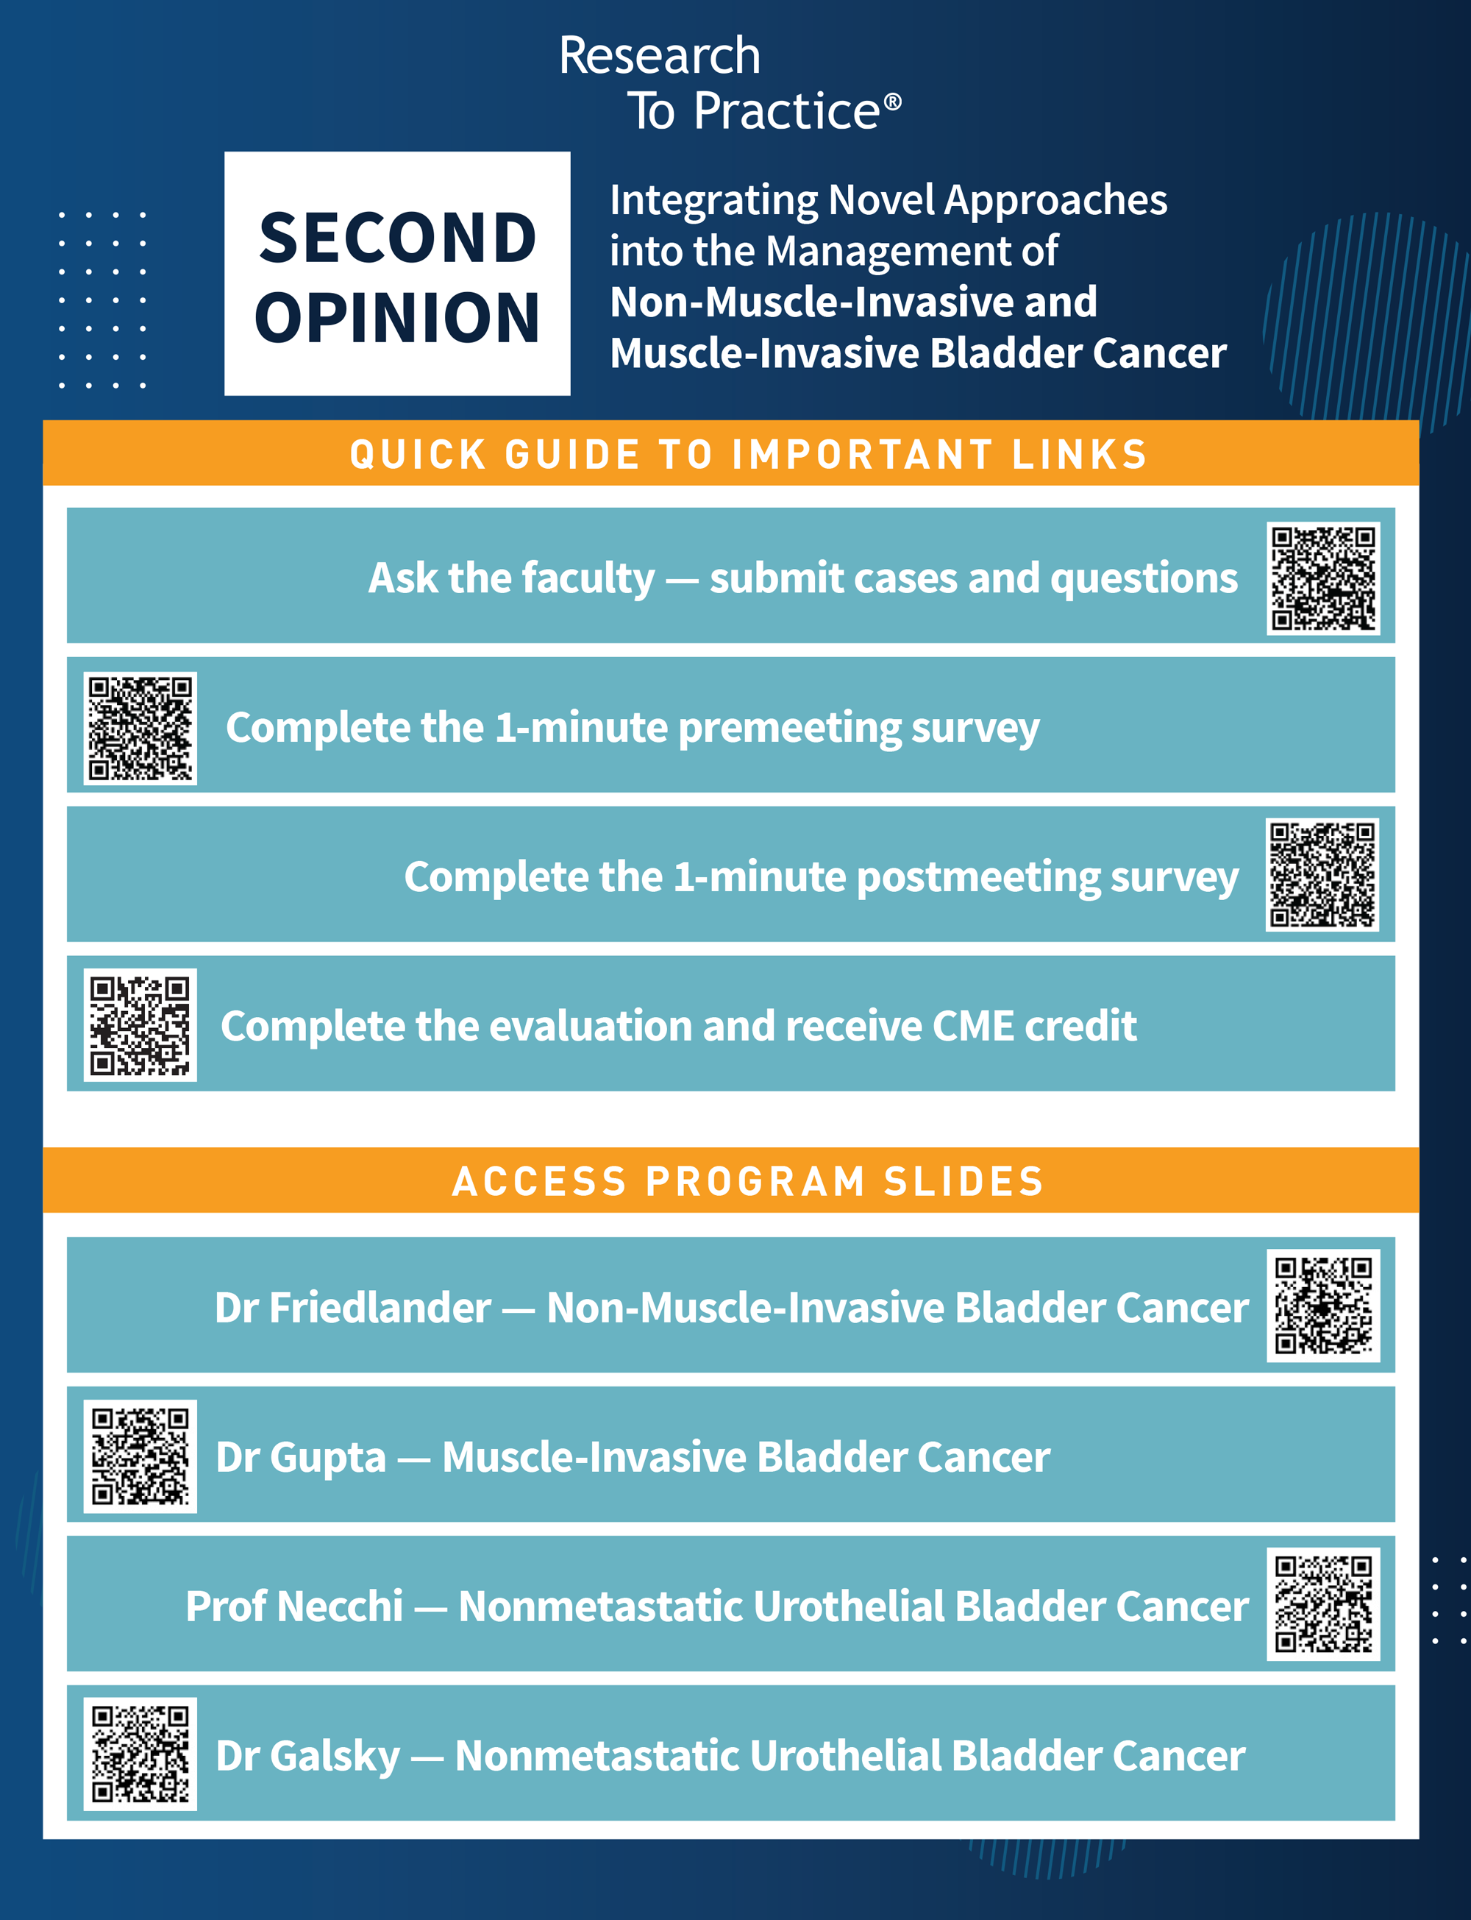




Clinicians in the Meeting Room
Please refer to the printed handout provided with your meeting syllabus, and scan the corresponding QR code to
Review and Download Program Slides.
Answer Survey Questions: Complete the pre-
and postmeeting surveys.
Ask a Question: We will aim to address as many questions as possible during the program.
Get CME Credit: Complete the course evaluation.
Notes:
14

Slide 15
Clinicians Attending via Zoom
Review Program Slides: A link to the program slides will be posted in the chat room at the start of the program.
Answer Survey Questions: Complete the pre- and postmeeting surveys.
Ask a Question: Submit a challenging case or question for discussion using the Zoom chat room.
Get CME Credit: A credit link will be provided in the chat room at the conclusion of the program.
Notes:
15

Slide 16

About the Enduring Program
The live meeting is being video
and audio recorded.
The proceedings from today will
be edited and developed into
an enduring web-based
program.
An email will be sent to all attendees when the activity is available.
To learn more about our education programs, visit our website, www.ResearchToPractice.com
Notes:
16
16

Slide 17
Second Opinion: Integrating Novel Approaches into the Management of Non-Muscle-Invasive and Muscle-Invasive Bladder Cancer
A CME Symposium Held Adjunct to the
2026 ASCO® Genitourinary Cancers Symposium
Thursday, February 26, 2026
7:00 PM – 9:00 PM PT (10:00 PM – 12:00 AM ET)
Faculty
Matthew D Galsky, MD
Shilpa Gupta, MD
Andrea Necchi, MD
Moderator
Terence Friedlander, MD

Slide 18
Agenda
Module 1: Optimal Use of Anti-PD-1/PD-L1 Antibodies in Non-Muscle-Invasive Bladder Cancer — Dr Friedlander
Module 2: Evolving Management of Muscle-Invasive Bladder Cancer —
Dr Gupta
Module 3: Current and Future Role of Novel Intravesical Therapies in Nonmetastatic Urothelial Bladder Cancer (UBC) — Dr Necchi
Module 4: Emerging Utility of Circulating Tumor DNA Evaluation in Nonmetastatic UBC — Dr Galsky

Slide 19
Agenda
Module 1: Optimal Use of Anti-PD-1/PD-L1 Antibodies in Non-Muscle-Invasive Bladder Cancer — Dr Friedlander
Module 2: Evolving Management of Muscle-Invasive Bladder Cancer —
Dr Gupta
Module 3: Current and Future Role of Novel Intravesical Therapies in Nonmetastatic Urothelial Bladder Cancer (UBC) — Dr Necchi
Module 4: Emerging Utility of Circulating Tumor DNA Evaluation in Nonmetastatic UBC — Dr Galsky

Slide 20

Optimal Use of Anti-PD-1/PD-L1 Antibodies in Non-Muscle-Invasive Bladder Cancer (NMIBC)
Terence Friedlander, MD
Clinical Professor
Robert and Virginia O’Reilly Family Endowed Chair
Helen Diller Family Comprehensive Cancer Center
University of California, San Francisco
Chief of Hematology-Oncology
Zuckerberg San Francisco General Hospital and Trauma Center
San Francisco, California

Slide 21
Outline
Rationale for use of PD-1 immunotherapy + BCG for treatment-naïve, high-risk NMIBC
Safety and Efficacy from recent Phase III trials
  CREST
  POTOMAC
  ALBAN
Future Directions

Slide 22
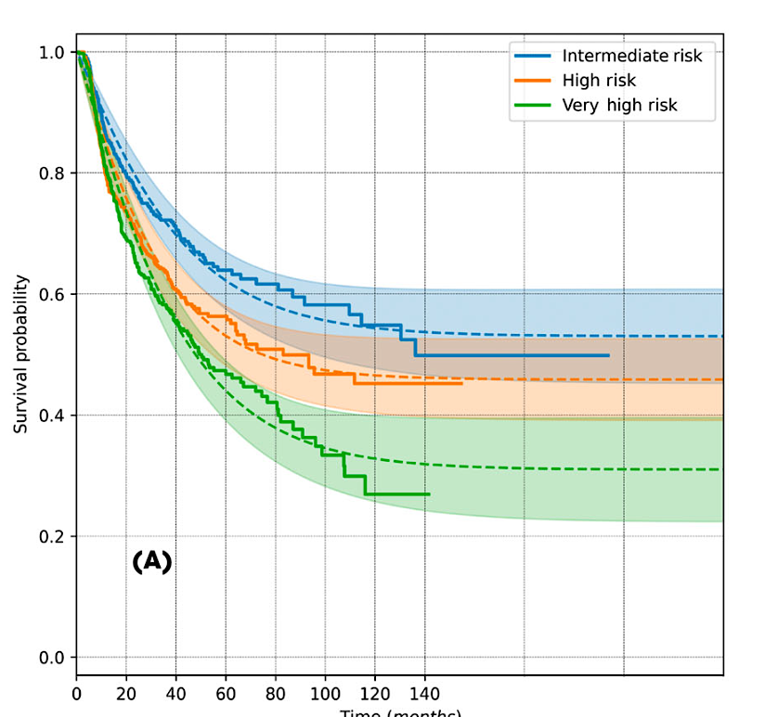
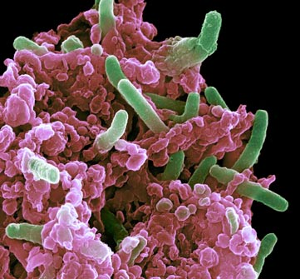
BCG is the Standard of Care for treatment-naïve NMIBC
Recurrence-Free Survival
Time (months)
Nature Medicine 2011, www.nccn.org, Subiela et al BJUI 2026

Slide 23

Why add PD-1 immunotherapy to BCG?
Immunologically
  BCG upregulates PD-L1 on tumors and tumor infiltrating lymphocytes (TIL)
  BCG-resistant tumors have higher PD-L1 expression
  Resistance associated with T-cell exhaustion
Clinically
  Unmet need for better therapies for high-risk NMIBC
  Synergy of 2 immunotherapies
    BCG addresses localized disease
    PD-1 addresses any disease beyond the urothelium
Fukumoto et al Ann Surg Onc 2018, Hashizume et al Oncotarget 2018, Lim et al Front Immunol 2021

Slide 24
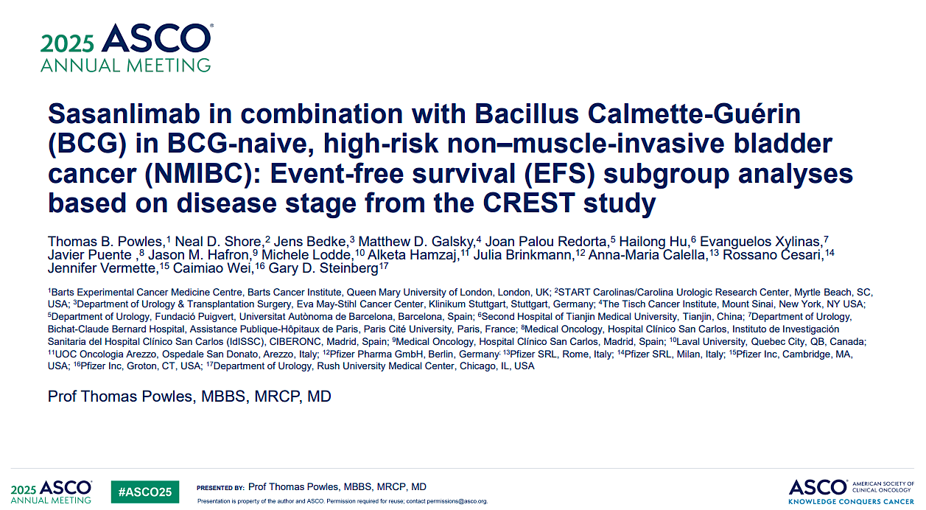

Slide 25
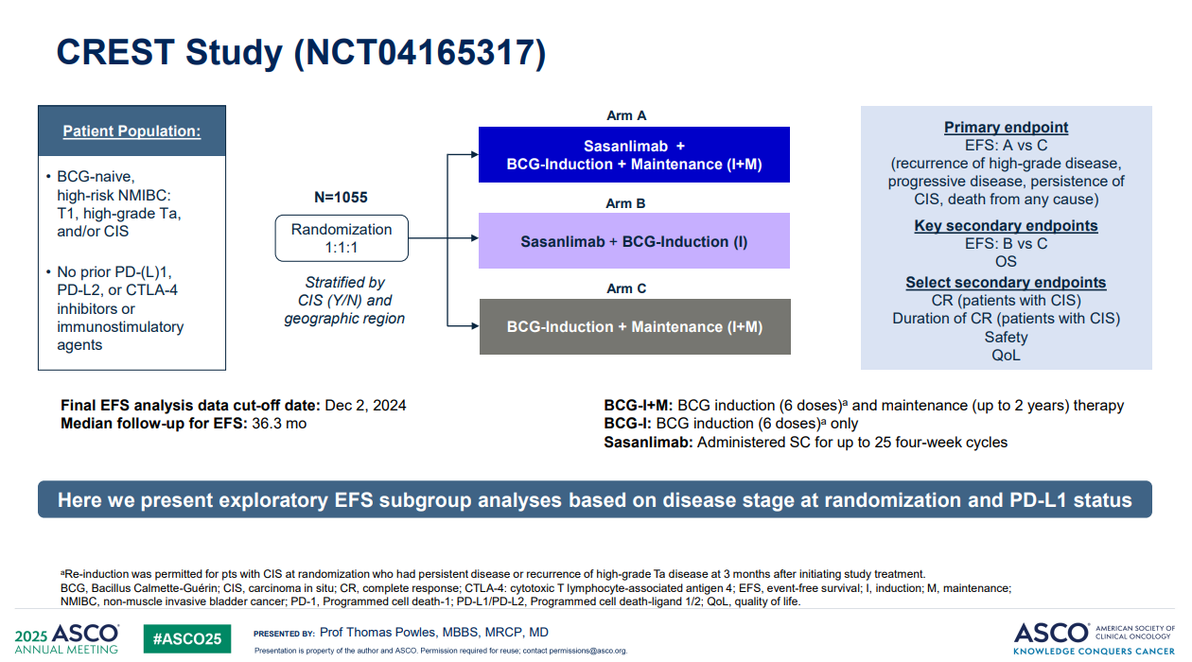
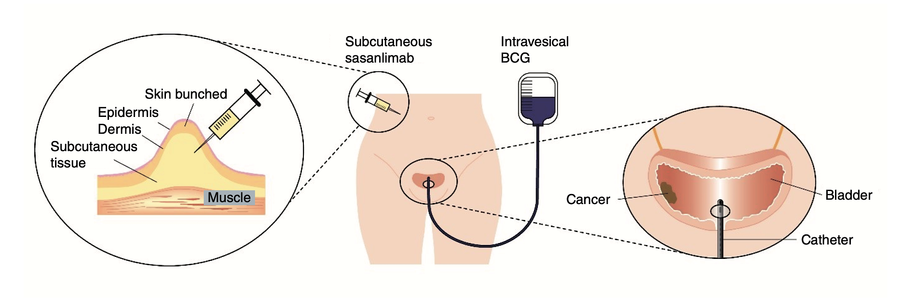
Sasanlimab
  Novel humanized IgG4 monoclonal anti-PD-1 ab
  Subcutaneous dosing 300mg q4 weeks
Steinberg et al Future Onc 2024

Slide 27
Shore et al AUA 2025

Slide 28
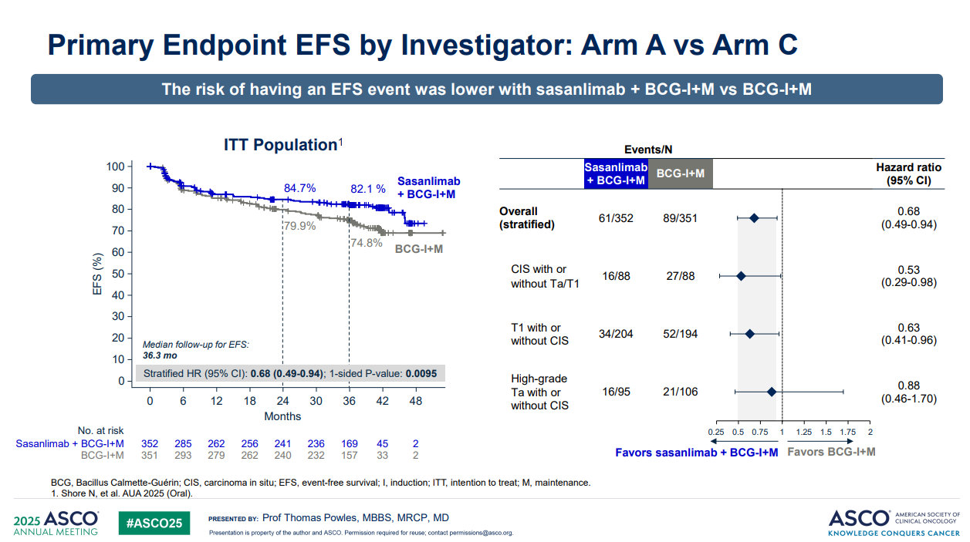
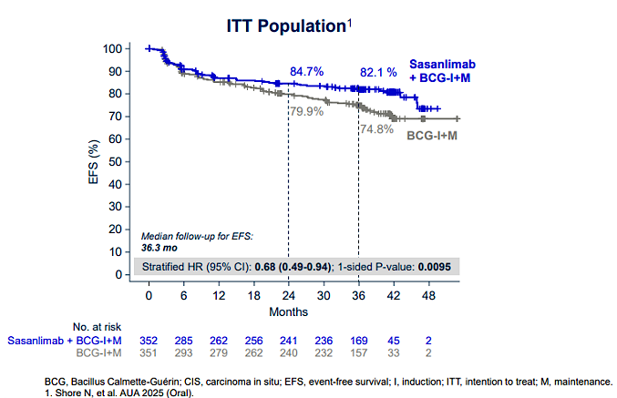

Slide 29
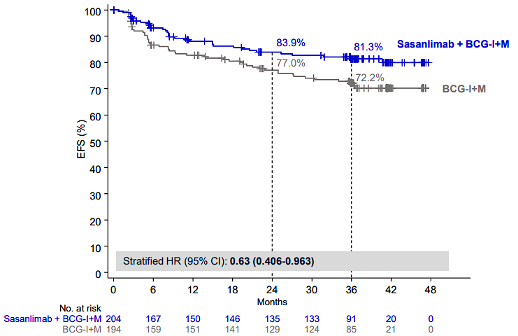
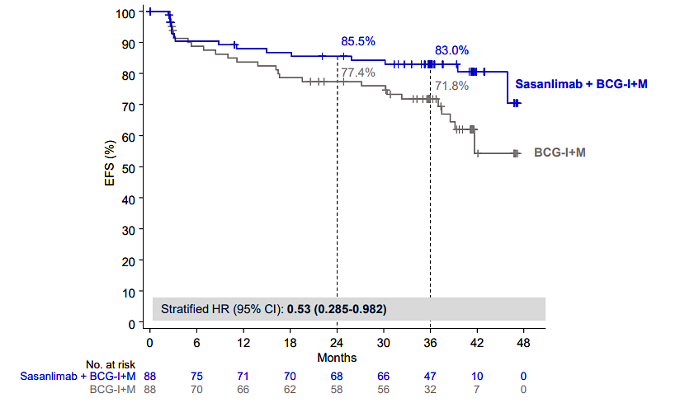
EFS by T stage: Arm A vs Arm C
T1 at baseline
CIS at baseline
Powles et al ASCO 2025

Slide 30
Shore et al AUA 2025

Slide 31
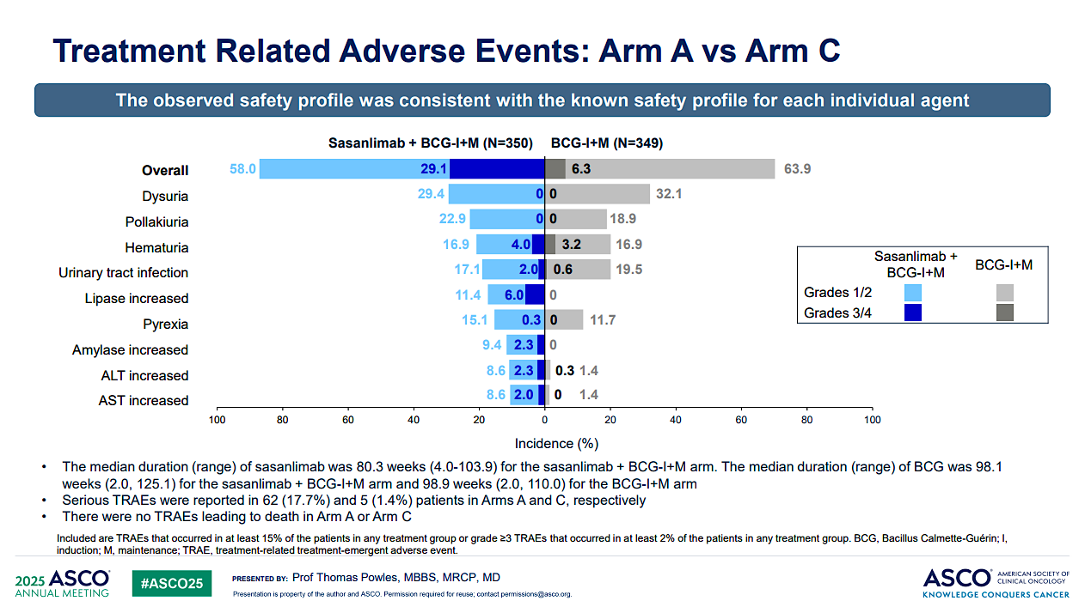

Slide 32
Impact on Practice
Sasanlimab combined with BCG induction and maintenance may become an option for high-risk BCG-naïve NMIBC
  Sasanlimab is not currently FDA approved
Is the side effect profile worth the benefit?
  How to balance EFS (positive), OS (immature) and Toxicity (real)?
Who will be giving this therapy? Urologists? Medical Oncologists?
What treatment(s) will we have at recurrence? Will other immunotherapies be effective?

Slide 39
Serious TRAEs
  Arm A 13%
  Arm C 4%

Slide 40
Impact on Practice
Similar results to CREST
  Met EFS primary endpoint
  Less activity in the CIS cohort?
    NO – the POTOMAC control arm did exceptionally well (93% CR at 6 months)
    The BCG + PD-1 CR rate was higher in POTOMAC (93%) than CREST (87%)
  OS immature at present
  Toxicity is as expected, but real
What is optimal duration of PD-1?
  1 year (POTOMAC) vs 2 years (CREST)
Likely we will need to see OS benefit before widely available

Slide 43
Trial | Primary Endpoint | Includes CIS Persistence | Includes Progression | Includes Death | References
POTOMAC | Disease-free survival | No | Implied (high-risk recurrence) | Yes | [1]
CREST | Event-free survival | Yes | Yes | Yes | [2]
ALBAN | Event-free survival | Not explicitly stated | Yes | Yes | [3-4]

Slide 46
Impact on Practice
Disappointing results
  Did not meet primary EFS nor secondary OS endpoints
Why?
  Shorter duration of BCG (1 year vs 2 years)
  Smaller study than POTOMAC and CREST (n=517 vs >1000)
  Follows on disappointing results in BCG-unresponsive pts (SWOG 1605)
    27% CR at 6 months vs 41% in Keynote 057

Slide 47
Summary
 | CREST | POTOMAC | ALBAN
ICI Agent | Sasanlimab (anti-PD-1) | Durvalumab (anti-PD-L1) | Atezolizumab (anti-PD-L1)
Route of Admin | SubQ | IV | IV
BCG Maintenance | 2 years | 2 years | 1 year
Sample Size | 1,055 | 1,018 | 517
Primary Endpoint HR | 0.68 (0.49-0.94) | 0.68 (0.50-0.93) | 0.98 (0.71-1.36)
Result | Positive | Positive | Negative
CIS Subgroup Benefit | Yes | No | No
OS benefit? | Immature | Immature | Immature
DeSantis et al. ESMO 2025; Powles et al. ASCO 2025; Roupret et al. ESMO 2025; Shore et al AUA 2025

Slide 48
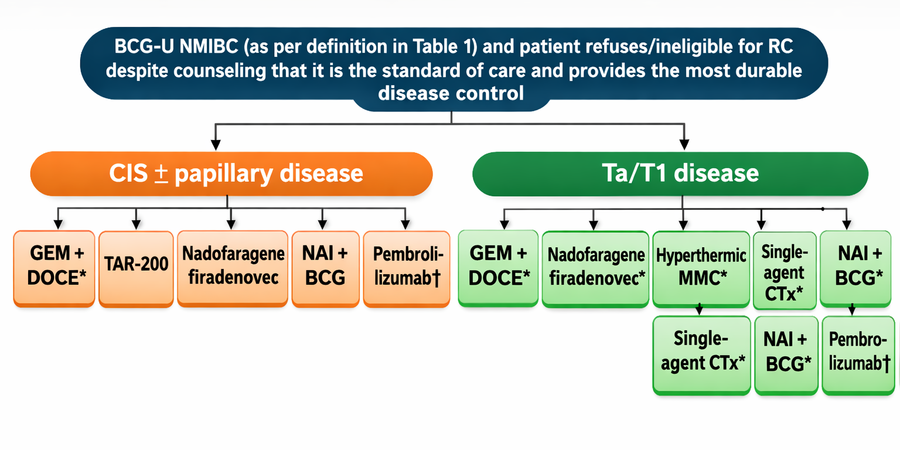
BCG-Unresponsive NMIBC
Pt refusing or ineligible for RC
Adapted from: Li and International Bladder Cancer Group, Eur Urol, 2024
Adapted from: Li and International Bladder Cancer Group, Eur Urol, 2024

Slide 49
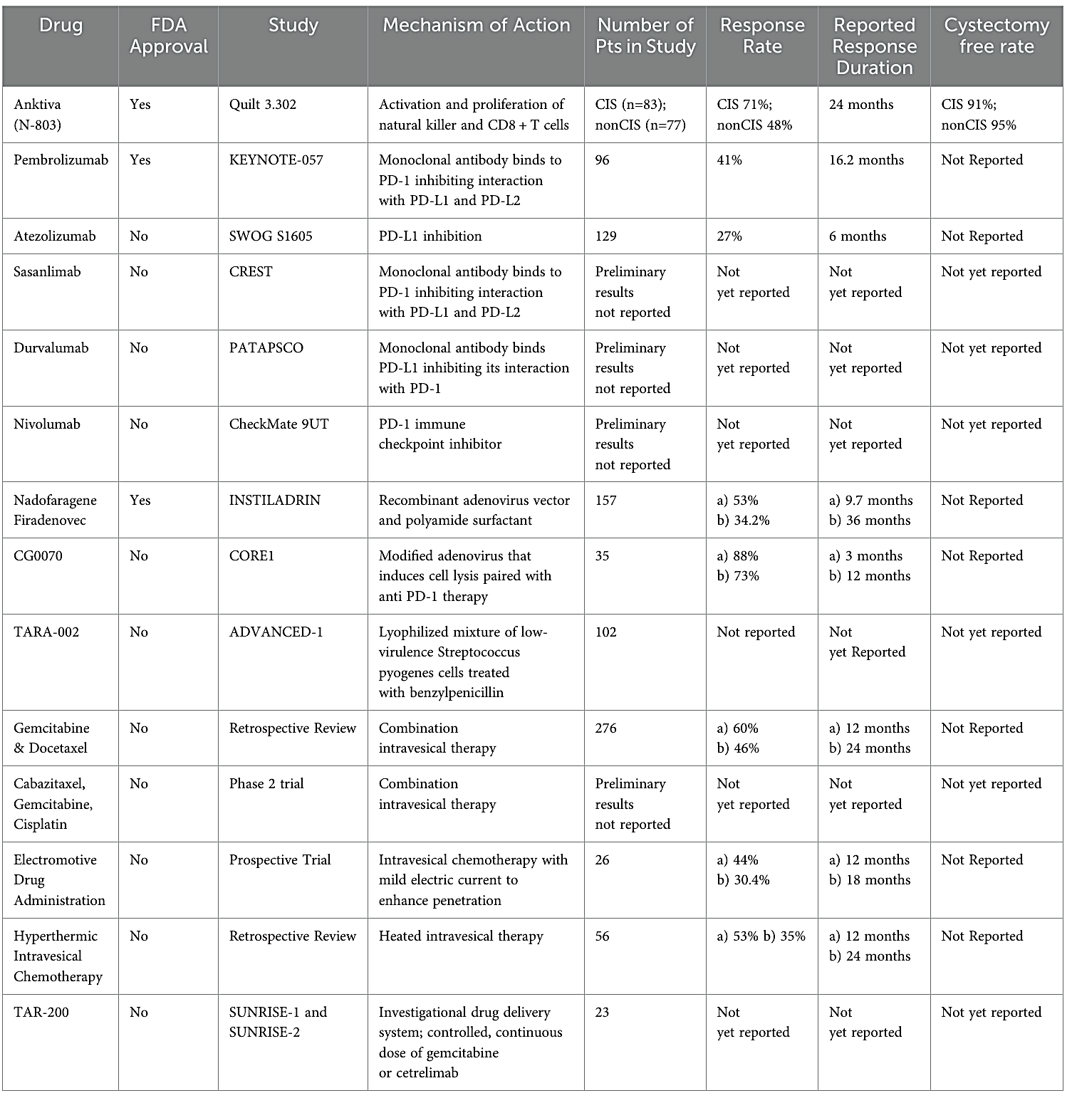
Many Ongoing Trials
Treatment naïve vs BCG-resistant
Multiple Modalities
  Intravesical
  Systemic
  Combinations
Viral or
Bacterial Vector
Chemotherapy
Wiesen B, et al Front. Oncol. 2025

Slide 50
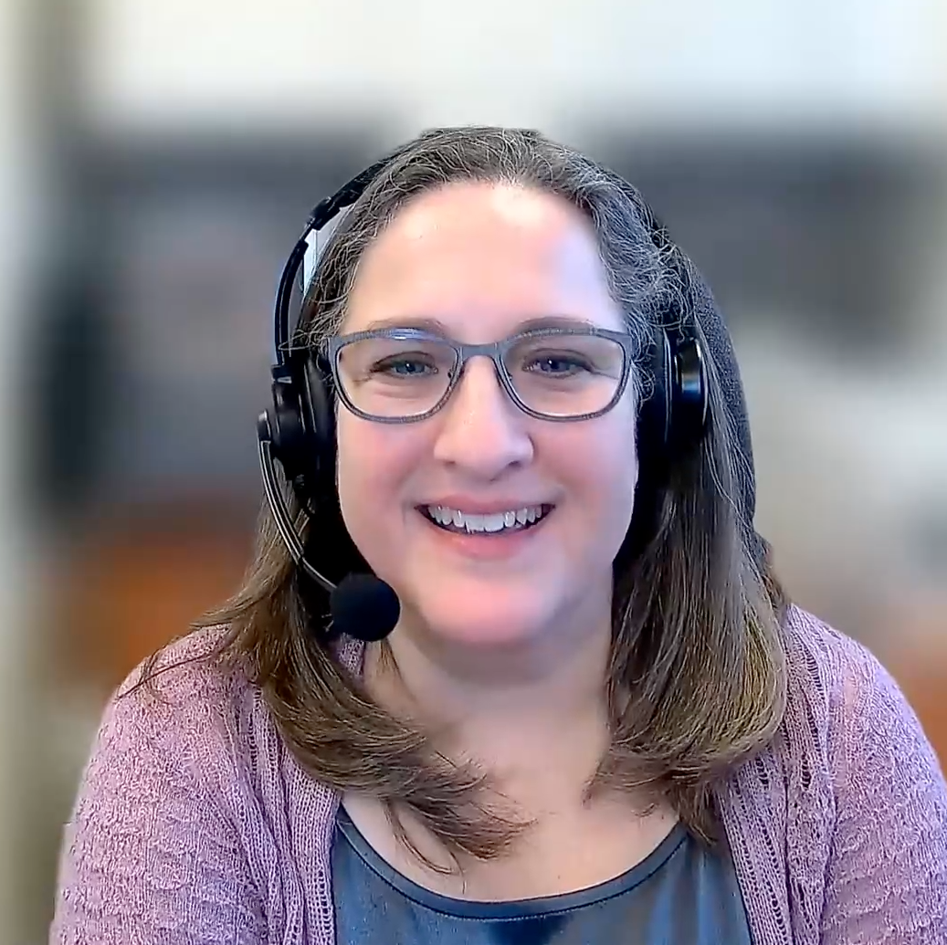

Second Opinion
Elizabeth R Plimack, MD, MS
Neil Love, MD

Slide 51
QUESTIONS FOR THE FACULTY
What treatment options would you discuss with this 72-year-old man with an active lifestyle who wants to avoid cystectomy and has received BCG induction with maintenance, gemcitabine/docetaxel, and nadofaragene firadenovec with eventual recurrence of high-grade NMIBC?
The patient does not want to receive pembrolizumab due to concerns about adverse events and lack of long-term efficacy. How would this impact your discussion?

Slide 52
QUESTIONS FOR THE FACULTY
In general, how do you layer TAR-200 (gemcitabine intravesical system) into your treatment recommendations for patients with NMIBC? How do you describe the unique mechanism of action of TAR-200 to your patients?
What treatment would you ultimately recommend for this patient?

Slide 53

Second Opinion
Thomas Powles, MBBS, MRCP, MD
Neil Love, MD

Slide 54
QUESTIONS FOR THE FACULTY
Regulatory and reimbursement issues aside, what would be your preferred treatment for this man in his late 70s with newly diagnosed NMIBC? Based on the results of the Phase III CREST and POTOMAC trials, would you consider BCG in combination with an anti-PD-1/PD-L1 antibody?
From your perspective, why were the results of CREST and POTOMAC, evaluating sasanlimab and durvalumab, respectively, in combination with BCG, positive, while the results of the ALBAN study investigating atezolizumab with BCG were not?

Slide 55
QUESTIONS FOR THE FACULTY
Given the positive outcomes from CREST and POTOMAC, do you anticipate that anti-PD-1/PD-L1 antibodies will soon be used routinely for patients who have not experienced failure of BCG?
In your opinion, which patients represent ideal candidates for anti-PD-1/PD-L1 antibodies in combination with BCG? If this strategy were to reach the clinic, would you prefer it for all patients with high-risk disease, or are there some for whom you would still opt for BCG alone or some other strategy?

Slide 56
QUESTIONS FOR THE FACULTY
Are you at all concerned that as we continue to move anti-PD-1/
PD-L1 antibodies earlier in the treatment course, we may be depriving ourselves of effective therapies should disease recurrence occur?

Slide 57
Agenda
Module 1: Optimal Use of Anti-PD-1/PD-L1 Antibodies in Non-Muscle-Invasive Bladder Cancer — Dr Friedlander
Module 2: Evolving Management of Muscle-Invasive Bladder Cancer —
Dr Gupta
Module 3: Current and Future Role of Novel Intravesical Therapies in Nonmetastatic Urothelial Bladder Cancer (UBC) — Dr Necchi
Module 4: Emerging Utility of Circulating Tumor DNA Evaluation in Nonmetastatic UBC — Dr Galsky

Slide 58
Evolving Management of Muscle-Invasive Bladder Cancer (MIBC)
Shilpa Gupta, MD
Cleveland Clinic Taussig Cancer Institute
February 26, 2026
E-mail: Guptas5@ccf.org
X: @shilpaonc

Slide 59
Completed Adjuvant IO trials in high-risk MIUC
High risk MIUC: if received NAC- ypT2-T4a/ypN+ or pT3-T4a/pN+ if not eligible for or declined adjuvant cisplatin-based chemotherapy
IMvigor010
CheckMate -274
AMBASSADOR
Atezolizumab
Nivolumab
Pembrolizumab
R
R
R
Observation
Placebo
Observation
Primary endpoint:
DFS
Primary endpoint:
DFS
Coprimary endpoints:
DFS and OS
Key secondary endpoints:
OS, DSS, distant
metastasis-free survival, NUTRFS
Key secondary endpoints:
OS, NUTRFS, DSS
Key secondary endpoints:
OS and DFS in
PD-L1–positive and
PD-L1–negative patients
Did not meet primary endpoint
DFS Improvement
OS trending \
DFS Improvement
No OS improvement
Courtesy of Shilpa Gupta, MD

Slide 60
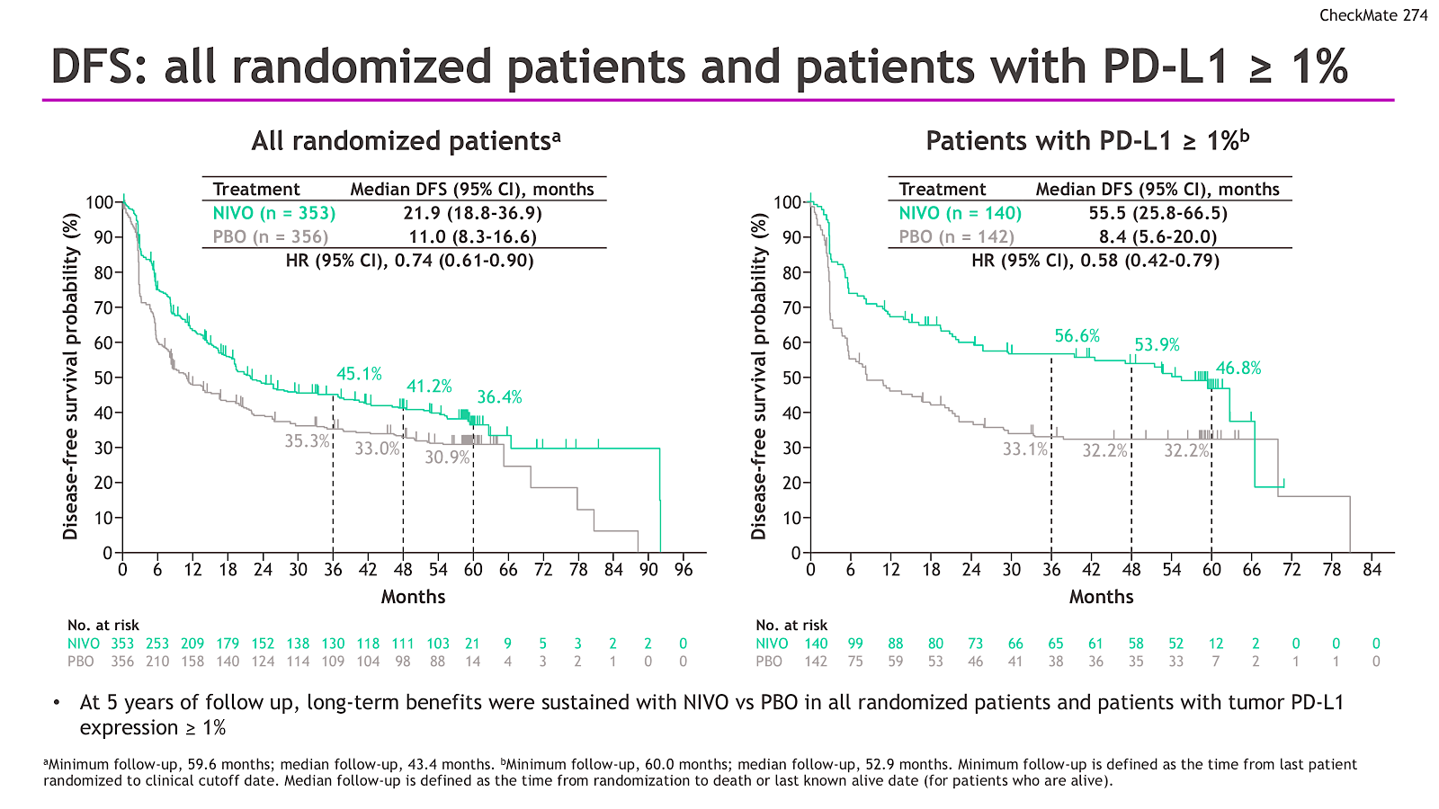
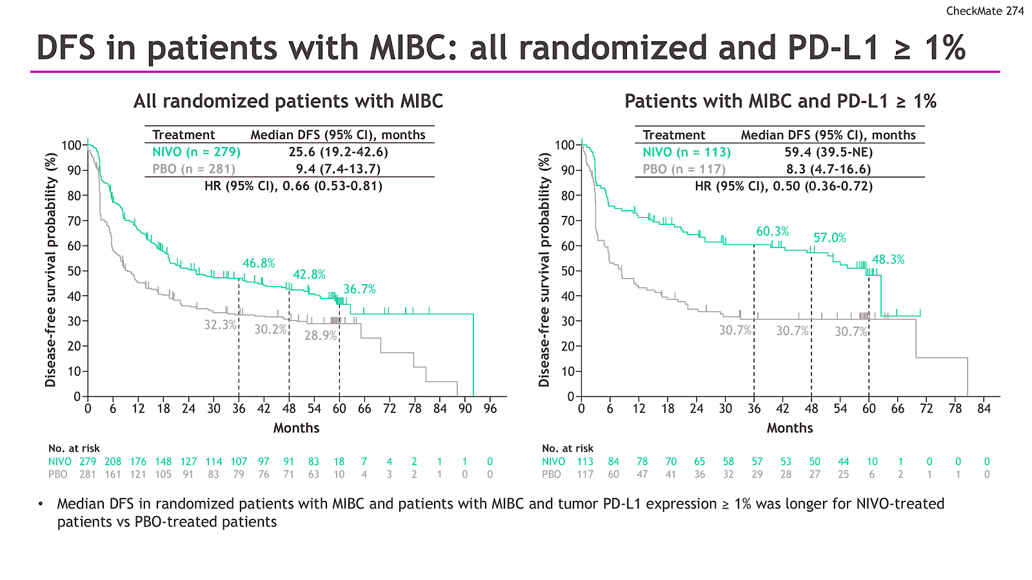
CheckMate-274 DFS 5-year follow-up
Galsky M et al. ESMO 2025

Slide 61
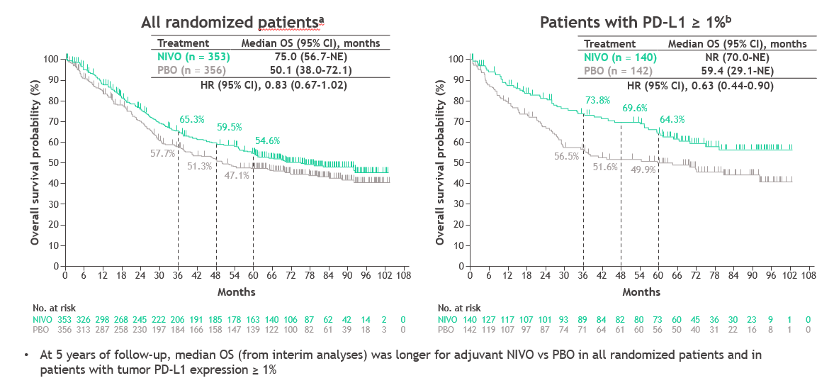
CheckMate-274 5 year OS trend with Nivo
Galsky M et al. ESMO 2025

Slide 62
Phase 3 Peri-operative IO-based Trials in MIBC
Clinical Trial | N | Treatment Arms | Eligibility
KEYNOTE-866 | 870 | Pembro + GC vs GC | T2-4aN0M0
KEYNOTE-B15/EV-304 | 784 | Pembro +EV vs GC | T2-T4aN0M0 T1-T4aN1M0
NIAGARA | 1050 | Durva+ GC vs GC | T2-4aN1M0
ENERGIZE | 1200 | Nivo + GC vs GC GC+ Nivo + Linrodostat | T2-4aN0M0
KEYNOTE-905/ EV-303 | 836 | RC vs Pembro+EV vs Pembro | T2-4aN0M0
VOLGA | 830 | RC vs Druva/Tremi+EV vs Durva+EV | T2-4aN0M0
CISPLATIN
ELIGIBLE
CISPLATIN-INELIGIBLE
Primary Endpoints pCR, EFS
Adjuvant IO in experimental arm
NO adjuvant IO in control arm
Courtesy of Shilpa Gupta, MD

Slide 63
NIAGARA: Study Design
Perioperative
Neoadjuvant
4 cycles
Adjuvant
8 cycles
Study population
Adults
Cisplatin-eligible MIBC (cT2–T4aN0/1M0)
UC or UC with
divergent differentiation or histologic subtypes
Evaluated and confirmed for RC
Durvalumab arm
Dual primary endpoints:
EFS*
pCR**
Key secondary endpoint:
OS
Radical cystectomy
Durvalumab 1500 mg IV Q3W Gemcitabine + cisplatin
Durvalumab
1500 mg IV Q4W
N=533
R
1:1
N=530
Gemcitabine + cisplatin
No treatment
Comparator
arm
EFS defined as:
Stratification factors
Gemcitabine/cisplatin dosing
Progressive disease that precluded RC
Recurrence after RC
Date of expected surgery in patients who did not undergo RC
Death from any cause
Clinical tumour stage (T2N0 vs >T2N0)
Renal function (CrCl ≥60 mL/min vs ≥40–<60 mL/min)
PD-L1 status (high vs low/negative expression)
CrCl ≥60 mL/min: Cisplatin 70 mg/m² + gemcitabine 1000 mg/m² Day 1, then gemcitabine 1000 mg/m² Day 8, Q3W for 4 cycles
CrCl ≥40–<60 mL/min: Split-dose cisplatin 35 mg/m² + gemcitabine 1000 mg/m² Days 1 and 8, Q3W for 4 cycles
Other endpoints (not reported here):
DFS, DSS, MFS, HRQoL, 5-year OS
Powles T et al. ESMO 2024, NEJM 2024

Slide 64
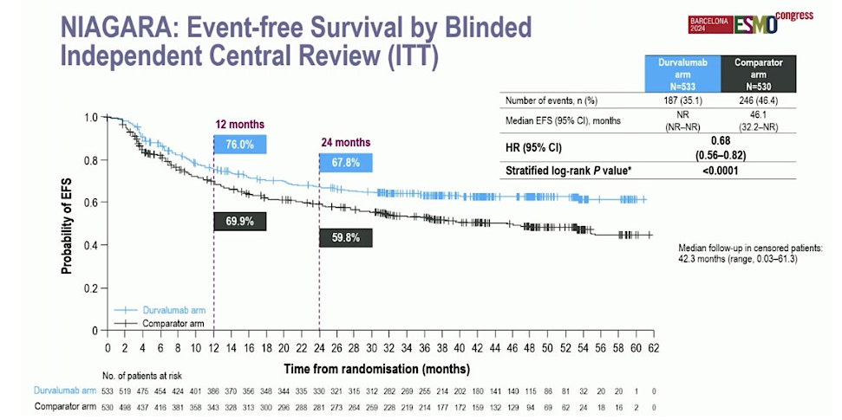
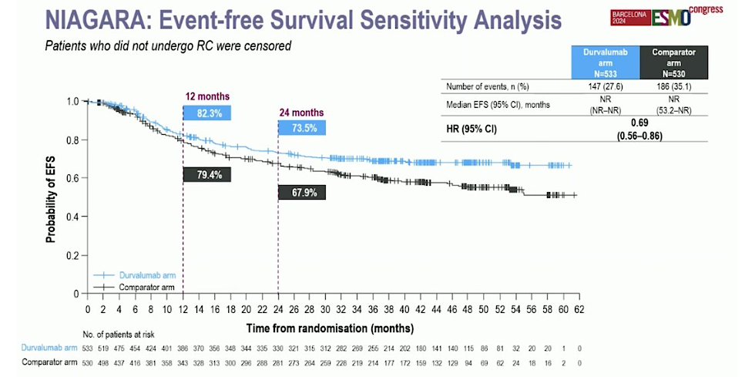
Powles T et al. ESMO 2024, NEJM 2024

Slide 65
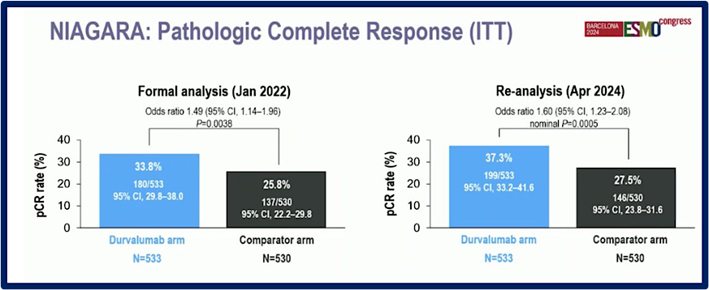
Powles T et al. ESMO 2024, NEJM 2024

Slide 66
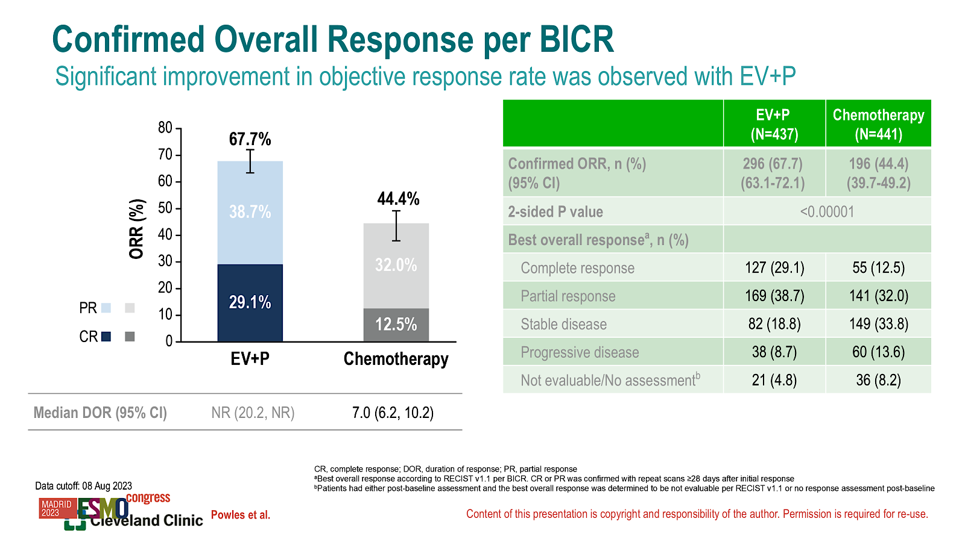
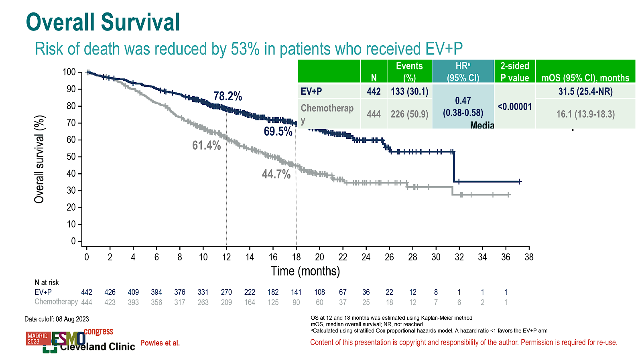
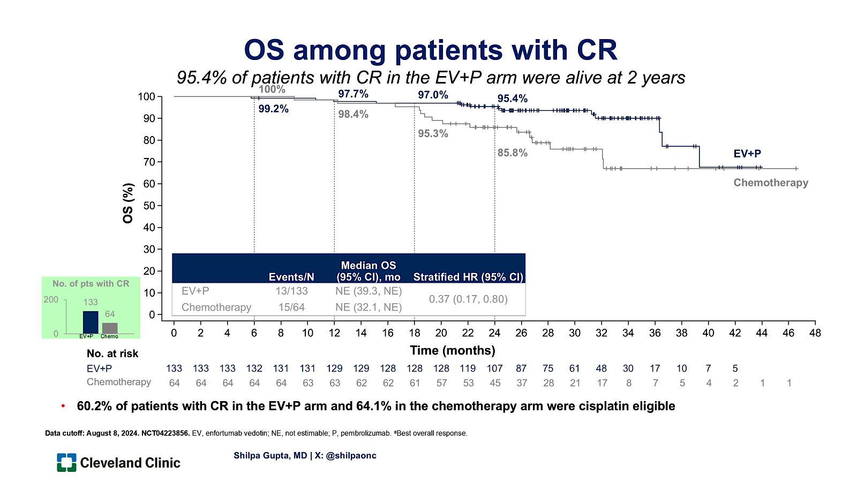
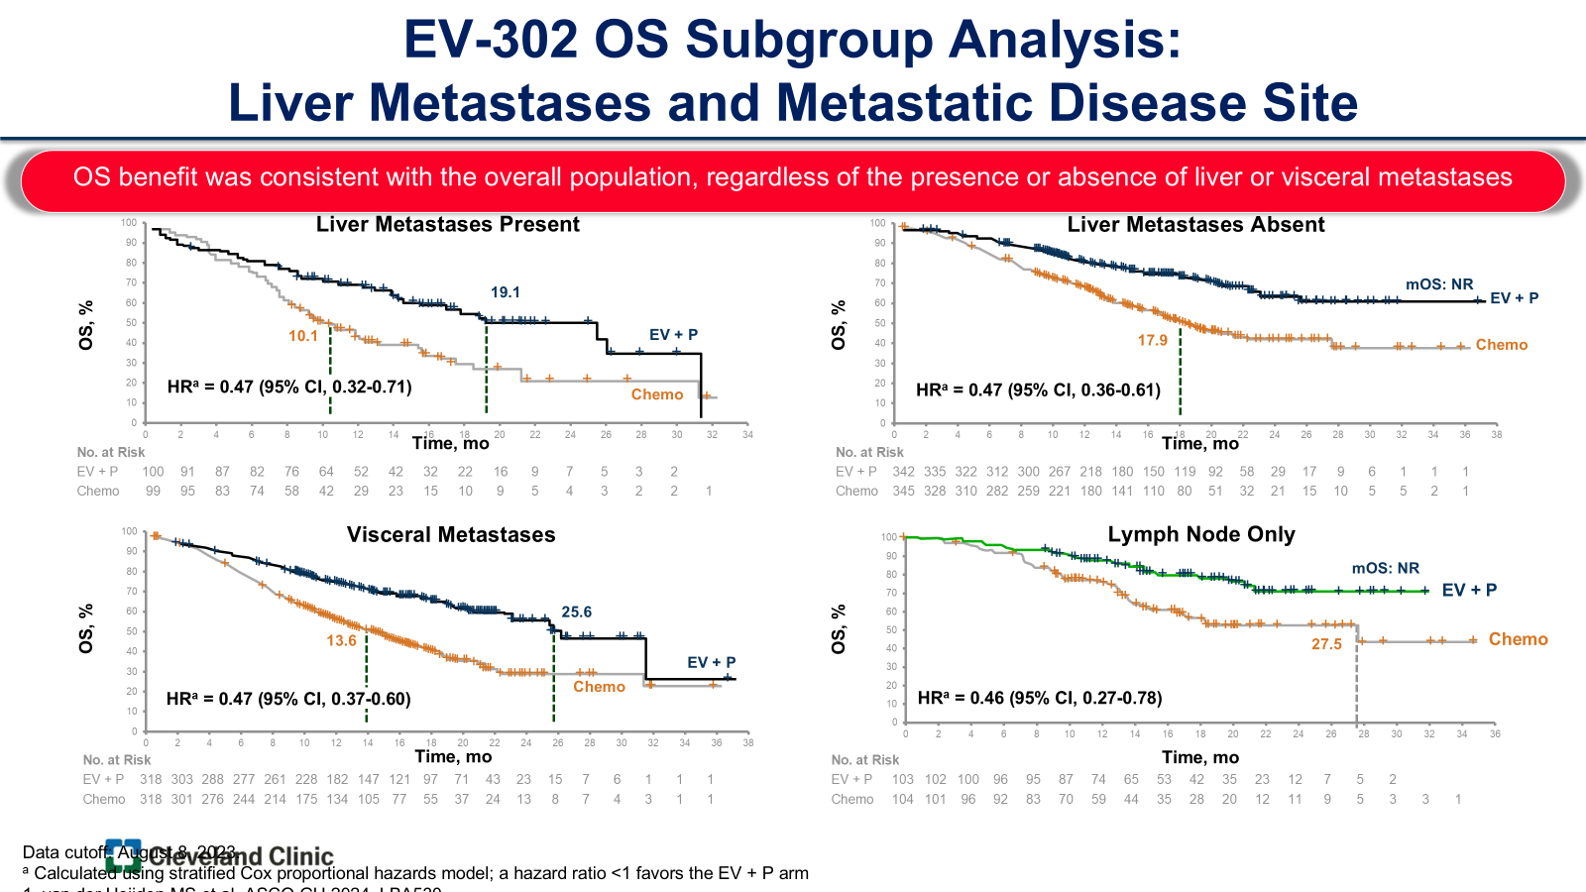
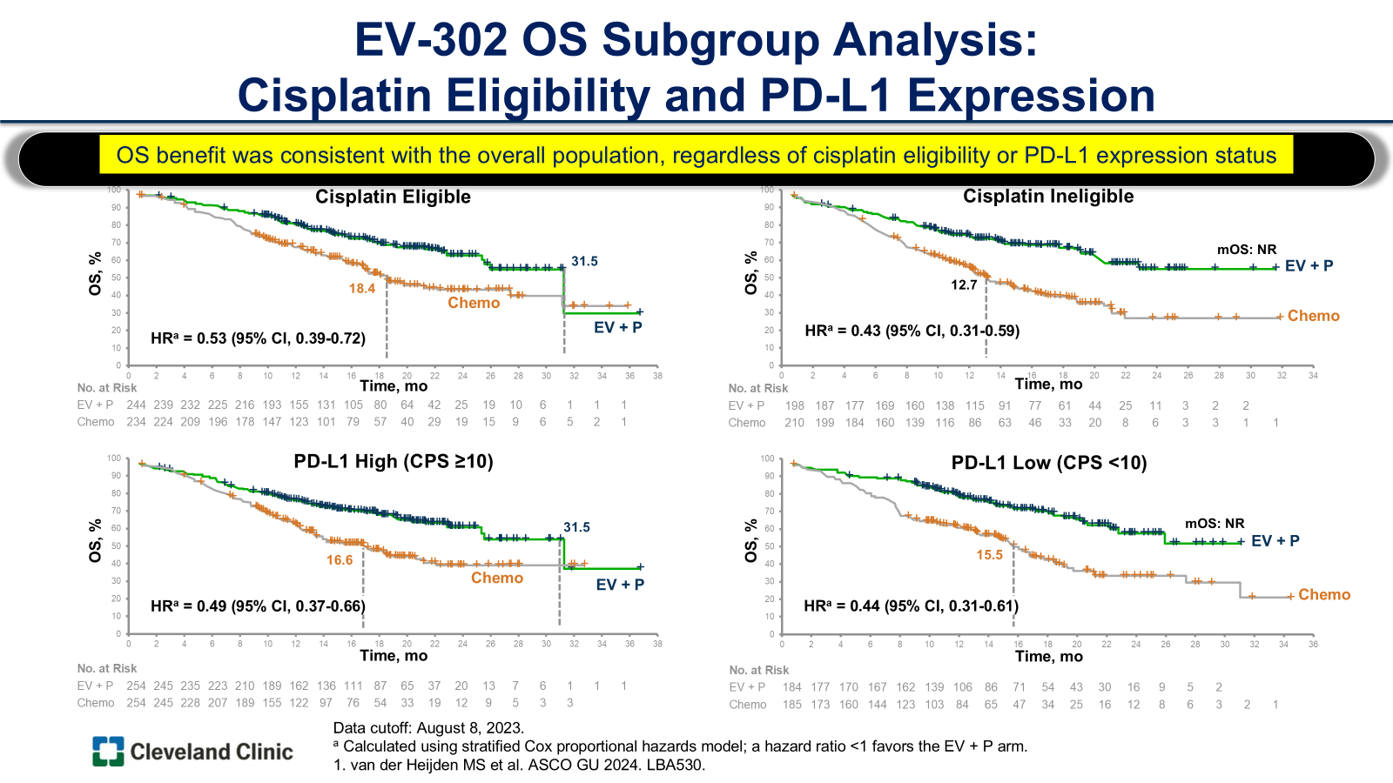
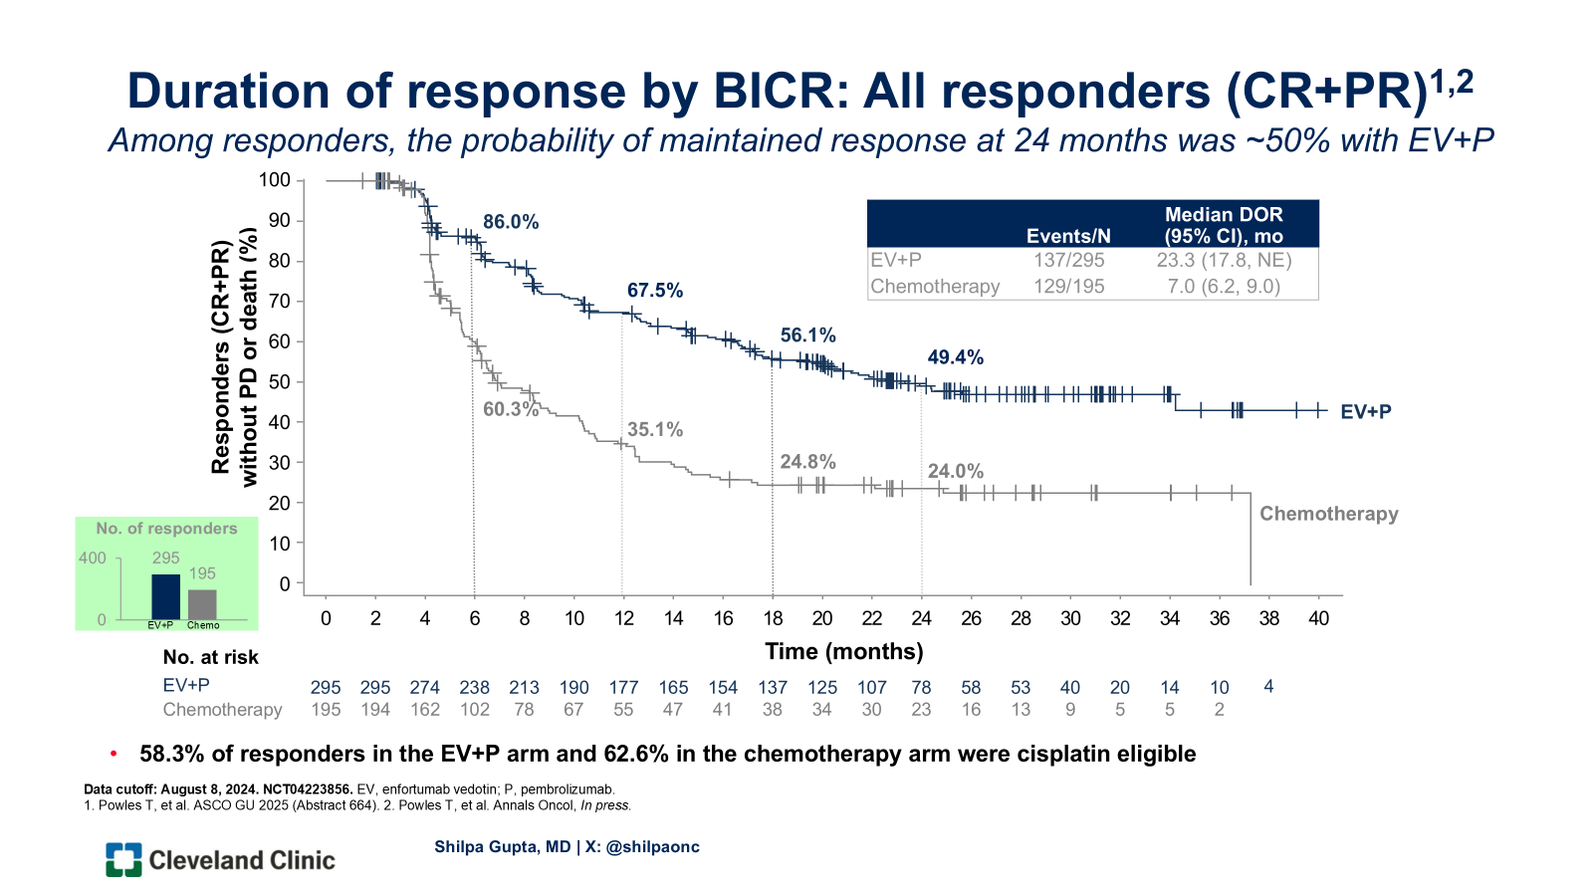
EV-Pembro has revolutionized the 1L treatment in mUC
Gupta et al. ASCO 2025; Powles et al. Ann Oncol. 2025; Powles et al. ESMO 2023; Powles T et al. NEJM 2024; Van Der Heijden et al. ASCO GU 2024

Slide 67

EV-pembro sets off a domino effect in MIBC

Slide 68
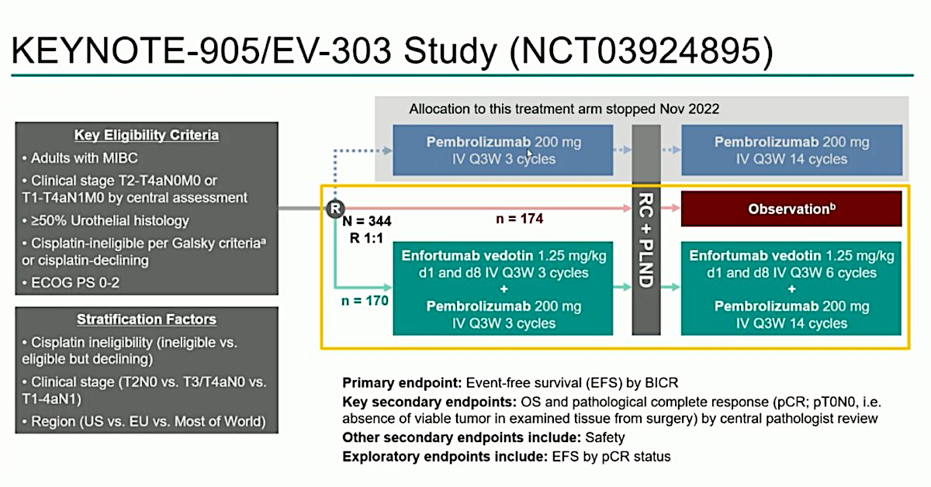
NO UTUC INCLUDED
Vulsteke C et al. ESMO 2025

Slide 69
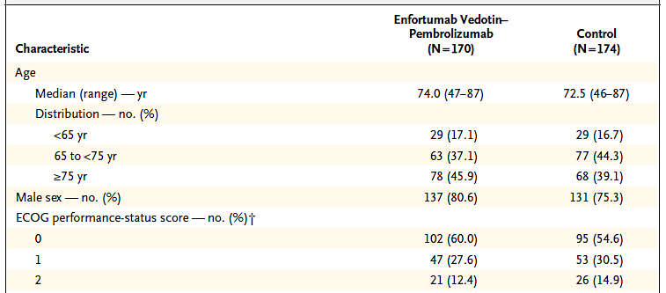

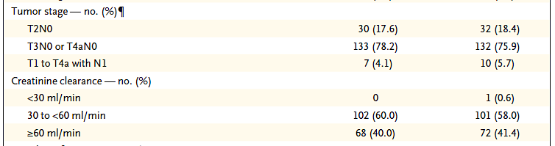
Older and more frail patient population
Vulsteke C et al. NEJM 2026

Slide 70
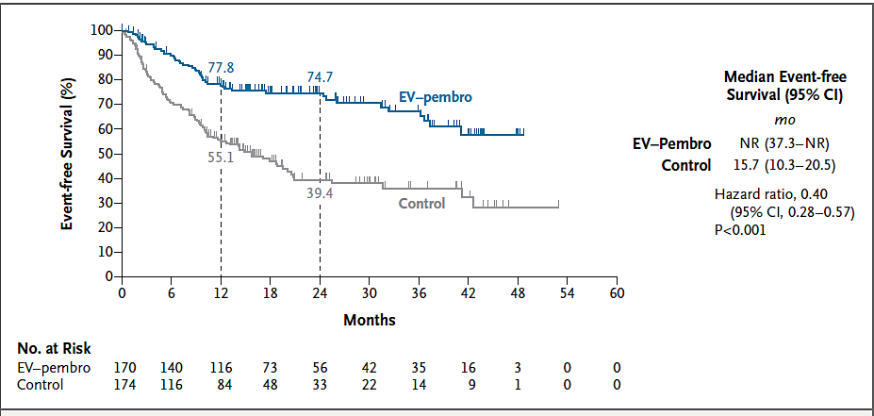
KEYNOTE-905/EV-303 EFS
Vulsteke C et al. NEJM 2026

Slide 71
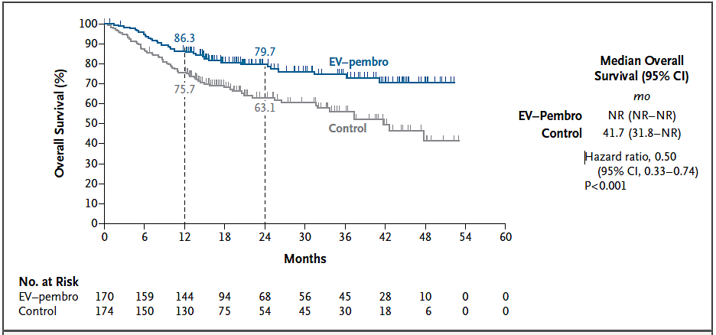
KEYNOTE-905/EV-303 OS
Vulsteke C et al. NEJM 2026

Slide 72
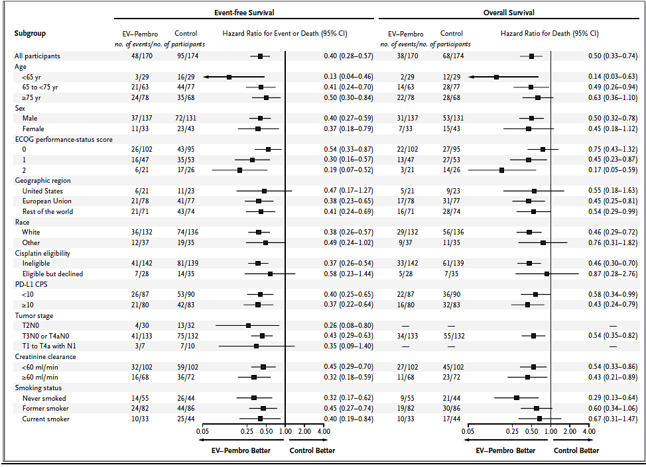
Benefit with EV-Pembro across subgroups
Vulsteke C et al. NEJM 2026

Slide 73
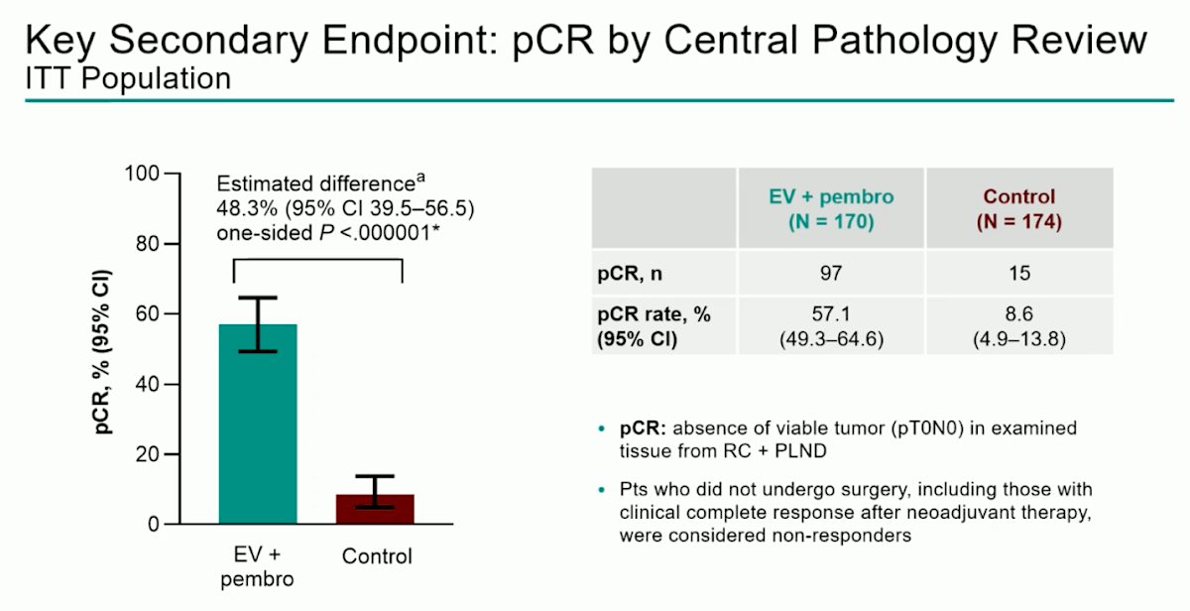
Vulsteke C et al. ESMO 2025

Slide 74
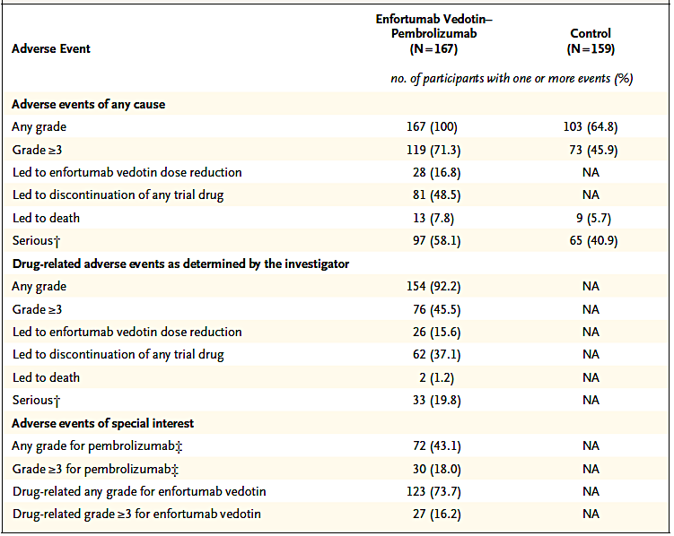
Safety
67% patients in EV-pembro arm got adjuvant therapy
Vulsteke C et al. NEJM 2026

Slide 75

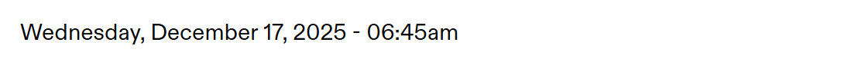
Press Release
EV 304: EV-P improves EFS and OS compared to Gem-Cis
Data to be presented tomorrow (Matt Galsky)
Enfortumab Vedotin-ejfv Plus Pembrolizumab Significantly
Improves Survival for Patients with Muscle-Invasive Bladder Cancer Regardless of Cisplatin

Slide 76
Conclusions and Future Directions
IO is now a backbone of peri-operative treatment in MIBC, EV-pembro will revolutionize treatment further replacing platinums
Need to personalize adjuvant therapy duration in patients with pCR using biomarkers such as ctDNA to avoid unnecessary toxicities
Unmet need to explore bladder preservation treatment strategies in patients achieving clinical complete response to neoadjuvant treatments

Slide 77
Second Opinion
Elizabeth R Plimack, MD, MS
Neil Love, MD

Slide 78
QUESTIONS FOR THE FACULTY
Do you agree with the original recommendation of adjuvant nivolumab for this 68-year-old woman with resected upper tract urothelial carcinoma? How would you have advised her?
Results of a ctDNA assay ordered for the patient were negative, and her CT scan was clear. What would be your approach to adjuvant treatment in this situation?
Do you routinely order ctDNA assays to inform treatment decisions for patients with MIBC? If so, what is your preferred platform? Are you more confident with tumor-informed versus tumor-agnostic assays? When assessing ctDNA, how often do you repeat the assay?

Slide 79
Second Opinion
Thomas Powles, MBBS, MRCP, MD
Neil Love, MD

Slide 80
QUESTIONS FOR THE FACULTY
What would be your most likely post-cystectomy treatment approach for this 77-year-old man with PD-L1-negative MIBC and poor renal function? Would you consider adjuvant nivolumab? What about enfortumab vedotin with pembrolizumab (EVP)?
Based on the results of the Phase III IMvigor011 trial evaluating ctDNA-guided use of adjuvant atezolizumab versus observation, is this a strategy you would recommend in this setting? If initial ctDNA analysis is negative, are you comfortable proceeding with observation accompanied by serial testing?

Slide 81
QUESTIONS FOR THE FACULTY
Do you believe ctDNA analysis can be used to identify patients who are at a high risk of relapse and might derive greater benefit from adjuvant systemic therapy? Can longitudinal ctDNA monitoring be used to identify patients who can be spared adjuvant systemic therapy?

Slide 82
Agenda
Module 1: Optimal Use of Anti-PD-1/PD-L1 Antibodies in Non-Muscle-Invasive Bladder Cancer — Dr Friedlander
Module 2: Evolving Management of Muscle-Invasive Bladder Cancer —
Dr Gupta
Module 3: Current and Future Role of Novel Intravesical Therapies in Nonmetastatic Urothelial Bladder Cancer (UBC) — Dr Necchi
Module 4: Emerging Utility of Circulating Tumor DNA Evaluation in Nonmetastatic UBC — Dr Galsky

Slide 83
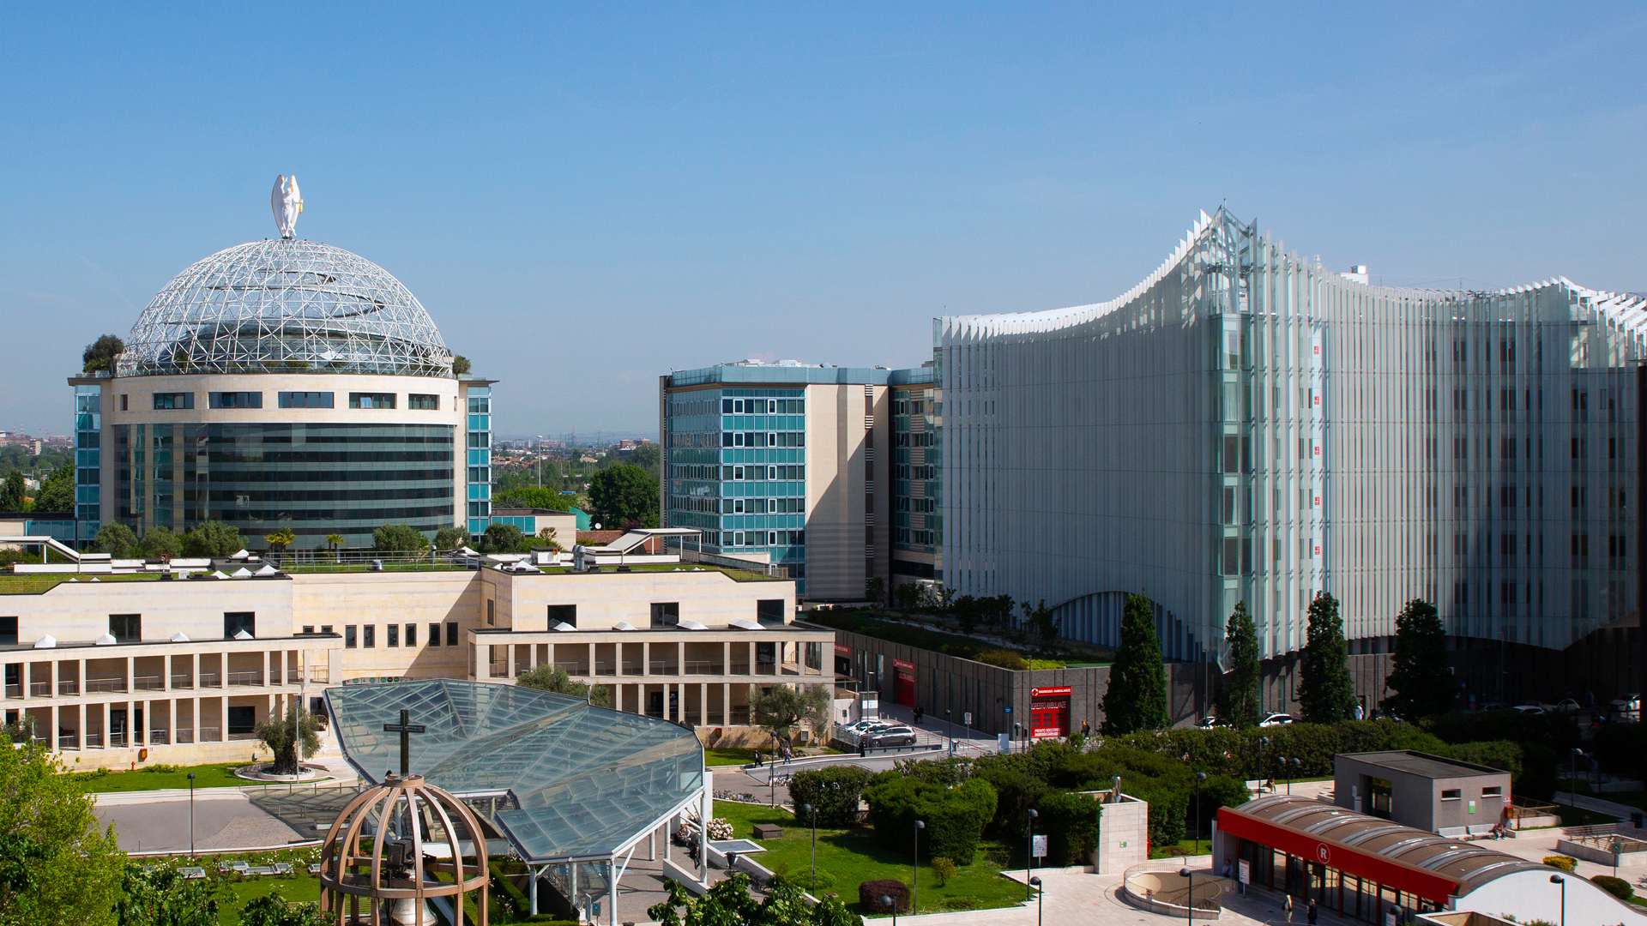
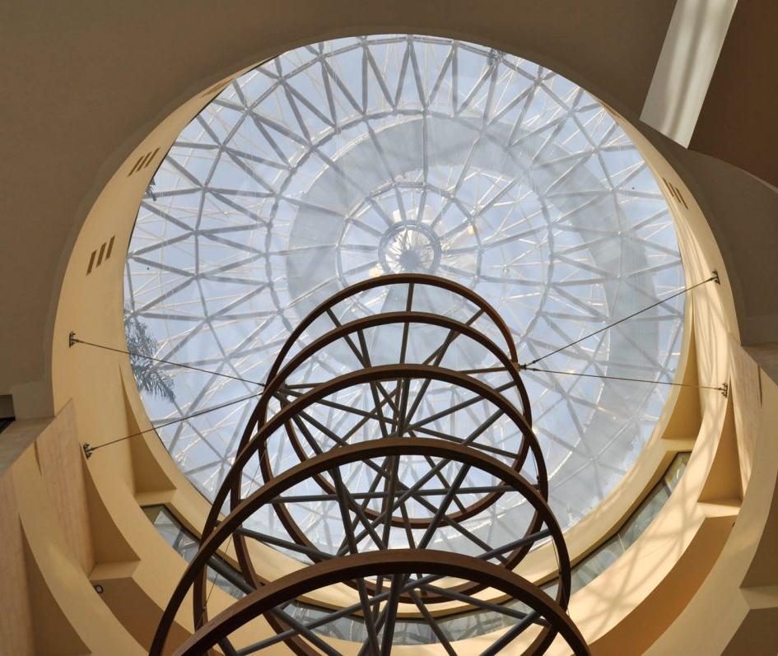



Current and Future Role of Novel Intravesical Therapies in Nonmetastatic UBC
Andrea Necchi, MD
Vita-Salute San Raffaele University
Director of Genitourinary Medical Oncology
IRCCS San Raffaele Hospital, Milan, Italy

Slide 84
Unmet Needs Across the Disease Spectrum
Only one-third of patients with NMIBC receive intravesical BCG¹
Many of those with NMIBC who are unresponsive to BCG experience recurrence or progression²
Close to half of patients with MIBC worldwide may not receive curative-intent therapy³
Patients who have undergone radical cystectomy for MIBC often have impaired HRQOL and a high risk of recurrence^{4,5}
  More than half of patients with mUC may not receive first-line systemic treatment^{4,5}
  Many patients with mUC who progress on 1L or 2L therapy do not receive subsequent treatment^{4,5}
In NMIBC, development of effective, safe, and durable intravesical treatment remains a critical unmet clinical need for patients who want to avoid radical cystectomy
In MIBC, effective consolidation approaches post neoadjuvant therapy in patients who refuse to undergo radical cystectomy are key to improve disease control and QoL
Clinical trial enrollment allows for modern advances to reach patients

Slide 85
Background
High-Risk NMIBC Is Defined as High-grade Ta, Any T1, and/or Carcinoma in situ
Standard of care for high-risk NMIBC: TURBT followed by intravesical BCG Prognosis is poor for patients whose disease does not respond to BCG or relapses within 12 months¹; these patients are directed to radical cystectomy
Criteria for the Definition of Adequate BCG and BCG-Unresponsive, High-Risk NMIBC Are Well Established and Endorsed by the FDA²
Adequate BCG induction: ≥5 instillations of BCG and ≥7 instillations within 9 months of the first instillation of induction therapy BCG-unresponsive, high-risk NMIBC is defined as one of the following Stage progression at 3 months despite adequate BCG induction High-grade T1 disease at first evaluation after adequate BCG induction Persistent high-risk NMIBC at 6 months after adequate BCG Recurrent high-risk NMIBC within 9 months of the last BCG instillation despite adequate BCG
BCG, Bacillus Calmette-Guerin; NMIBC, nonmuscle-invasive bladder cancer; RC, radical cystectomy; TURBT, transurethral resection of bladder tumor.
1. Jeong et al. BMC Cancer. 2022;22:361. 2. Kamat AM et al. J Clin Oncol. 2016;34:1935–1944.

Slide 86
Treatment approaches for high-risk NMIBC unresponsive to BCG
Immune checkpoint inhibition via PEMBRO
Phase 3 KEYNOTE-057
FDA approved January 2020¹
FGFR inhibition via intravesical delivery of ERDA-TAR-210²
Phase 1
CG0070 (cretostimogene)
Phase 3 BOND-003³
CG0070 + PEMBRO
Phase 2 CORE1⁴
FDA breakthrough designation
Intravesical delivery system for sustained release of gem via TAR-200
Phase 2b SunRISe-1⁵⁻⁷
Phase 3 SunRISe-3⁸
Phase 3 SunRISe-5⁹
FDA breakthrough designation
BCG-unresponsive NMIBC
Viral gene transfer: nadofaragene firadenovec¹⁰⁻¹²
FDA approved December 2022
IL-15 superagonist (N-803/NAI)
Phase 2/3 QUILT¹³⁻¹⁵
FDA approved April 2024
Gem + docetaxel
Approach for BCG-naive¹⁷
Phase 3 BRIDGE/EA8212:
BCG vs gem/docetaxel¹⁸
Intravesical ADC (EV)
EV-104¹⁶
Phase 1
ADC, antibody-drug conjugate; BCG, Bacillus Calmette-Guerin; ERDA, erdafitinib; EV, enfortumab vedotin; FGFR, fibroblast growth factor receptor; gem, gemcitabine; IL, interleukin; NAI, nogapendekin alfa inbakicept; NMIBC, nonmuscle-invasive bladder cancer; PEMBRO, pembrolizumab. 1. Balar AV et al. Lancet Oncol. 2021;22:919-930. 2. Vilaseca A et al. AUA 2024. Abstract PD48-02. 3. Tyson MD et al. AUA 2024. Abstract P2-02. 4. Li R et al. Nat Med. 2024 Jun 6. doi: 10.1038/s41591-024-03025-3. Online ahead of print. 5. Daneshmand S et al. AUA 2023. LBA 02-03. 6. Necchi A et al. ESMO 2023. LBA105. 7. Jacob J et al. AUA 2024. Abstract P2-01. 8. ClinicalTrials.gov https://clinicaltrials.gov/study/NCT05714202. 9. ClinicalTrials.gov https://clinicaltrials.gov/study/NCT06211764. 10. Boorjian SA et al. Lancet Oncol. 2021;22:107–117. 11. Mitra AP et al. AUA 2022. Abstract MP54-05. 12. ADSTILADRIN® (nadofaragene firadenovec-vncg) [package insert]. Kastrup, Denmark: Ferring Pharmaceuticals; August 2024. 13. Chamie K. NEJM Evidence. 2022;2(1):1–11. 14. ClinicalTrials.gov https://clinicaltrials.gov/study/NCT03022825. 15. https://www.fda.gov/drugs/resources-information-approved-drugs/fda-approves-nogapendekin-alfa-inbakicept-pmln-bcg-unresponsive-non-muscle-invasive-bladder-cancer. Accessed August 29, 2024. 16. Kamat AM et al. J Clin Oncol. 2023;41(suppl 16). Abstract 4596. 17. McElree IM et al. J Urol. 2022;208:589-599. 18. Kates M et al. Eur Urol Focus. 2023;9(4):561–563.

Slide 87
TAR development in Nonmetastatic Bladder Cancer
MoonRISe-3
TAR-210 vs gem/MMC
TAR-200 ± CET
TAR-210
*Nonregistrational. BCG, bacillus Calmette–Guerin; CET, cetrelimab; CIS, carcinoma in situ; CRT, chemoradiotherapy; FIH, first-in-human; gem, gemcitabine; MIBC, muscle-invasive bladder cancer; MMC, mitomycin C; mUC, metastatic urothelial carcinoma; NMIBC, non–muscle-invasive bladder cancer.

Slide 88
Phase 2b SunRISe-1 Study: Cohort 2 BCG-Unresponsive
HR NMIBC CIS ± Papillary Disease
NCT04640623
Population:
Aged ≥18 years
Histologically confirmed
HR NMIBC CIS (with or without papillary disease)
ECOG PS of 0-2
Persistent or recurrent disease within 12 months of completion of BCG
Unresponsive to BCG^{1,2} and not receiving RC
TAR-200 + Cetrelimab^{b}
Cohort 1 (N=53)^{c}
Cohort 1 was closed
TAR-200 dosing:
Q3W (indwelling) for the first 24 weeks;
then Q12W through
Week 96
Cohorts 1-3:
Primary end point
Overall CR rate
Key secondary end points
Duration of response
Overall survival
Safety
Tolerability
HRQoL
TAR-200 Monotherapy
Cohort 2 (N=85)
Enrollment completed
R
Cetrelimab^{b} Monotherapy
Cohort 3 (N=28)
Cohort 3 was closed
Population:
Papillary-only HR NMIBC
(no CIS)ª
TAR-200 Monotherapy
Cohort 4 (N=52)
Enrollment completed
Cohort 4:
Primary end point
DFS
  Here we report 1-year durability data from the TAR-200 monotherapy cohort (Cohort 2) of SunRISe-1
  Response is determined by quarterly cystoscopy, quarterly central cytology, mandated bladder biopsy by central assessment at Weeks 24 and 48, and local
  imaging Q24W
  The study protocol did not allow re-induction for nonresponders, consistent with US FDA guidance²
  As of June 2023, Cohorts 1 and 3 were closed for enrollment, and Cohort 2 enrollment continued to achieve N=85, per protocol amendment

Slide 89
Highest CR Rate to Date With Rapid Onset After TAR-200 Monotherapy in BCG-Unresponsive HR NMIBC CIS ± Papillary Disease
CR Rate From Treatment Initiation | Observed Overall CR Rate, % (n/N)
12 months^{b} | 45.9 (39/85)
Overall CR rate (central review)ª
82.4%
(95% CI, 72.6-89.8)
 | KM Estimated Overall CR Rate, % (95% CI)
12 months | 52.4 (40.7-62.8)
24 months | 44.7 (33.1-55.7)
CR
(n=70)
  Rapid onset of response: median time to onset, 2.8 months (range, 2.1-8.3)
  95.7% (67 of 70) CRs achieved at the first (3 month) disease assessment
FDA Breakthrough Therapy Designation
(N=85)
Daneshmand S, et al. J Clin Oncol. 2025 Nov 20;43(33):3578-3588.

Slide 90
Durable Responses With TAR-200 Monotherapy
Estimated 12-month DOR^{b} probability
56.2%
(95% CI, 43.4-67.1)
Estimated 24-month DOR probability
51.8%
(95% CI, 38.7-63.4)
25.8 months (95% CI, 8.3-NE) median DOR
Of 70 responders:
  23 (32.9%) had HR NMIBC recurrence^{c}
  4 (5.7%) had ≥T2 progression^{c}
86.6% (95% CI, 76.6-92.6) cystectomy-free rate at 12 months
100
80
60
Patients With CRª, %
40
20
0
0
3
6
9
12
15
18
21
24
Months Since CR
Number at risk
70
54
49
40
37
23
15
11
11
Daneshmand S, et al. J Clin Oncol. 2025 Nov 20;43(33):3578-3588.

Slide 91
TAR-200 Monotherapy Safety Profile
  Most TEAEs were grade 1 or 2
    TEAEs resolved after a median of 3.1 weeks
  99% (745 of 755) insertion success rate
  5 patients (5.9%) had ≥1 serious TRAEsª
  Few patients (n=3; 3.5%) discontinued treatment due to TRAEs^{b}
  No treatment-related deaths were reported
Patients With Events, n (%) | TAR-200 Monotherapy Cohort 2 (N=85)^{c}
 | Any Grade | Grade ≥3
≥1 TRAE^{d} | 71 (83.5) | 11 (12.9)
Most frequent TRAEs^{e,f}
Pollakiuria | 37 (43.5) | 0
Dysuria | 34 (40.0) | 0
Micturition urgency | 21 (24.7) | 0
Urinary tract infection | 19 (22.4) | 1 (1.2)
Hematuria | 14 (16.5) | 0
Urinary tract pain | 9 (10.6) | 4 (4.7)
Bladder pain | 7 (8.2) | 2 (2.4)
Bladder spasm | 7 (8.2) | 0
Noninfective cystitis | 6 (7.1) | 0
Urinary incontinence | 5 (5.9) | 0

Slide 92
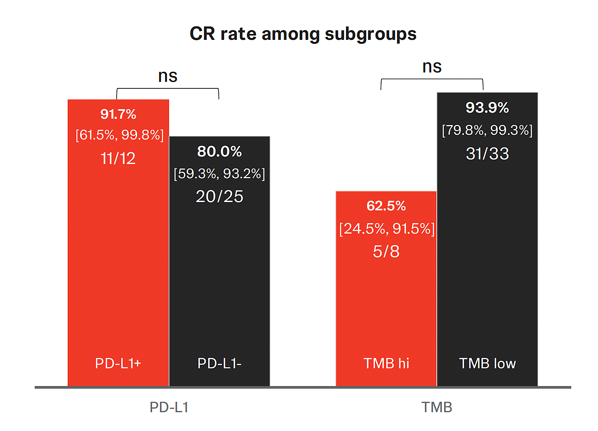
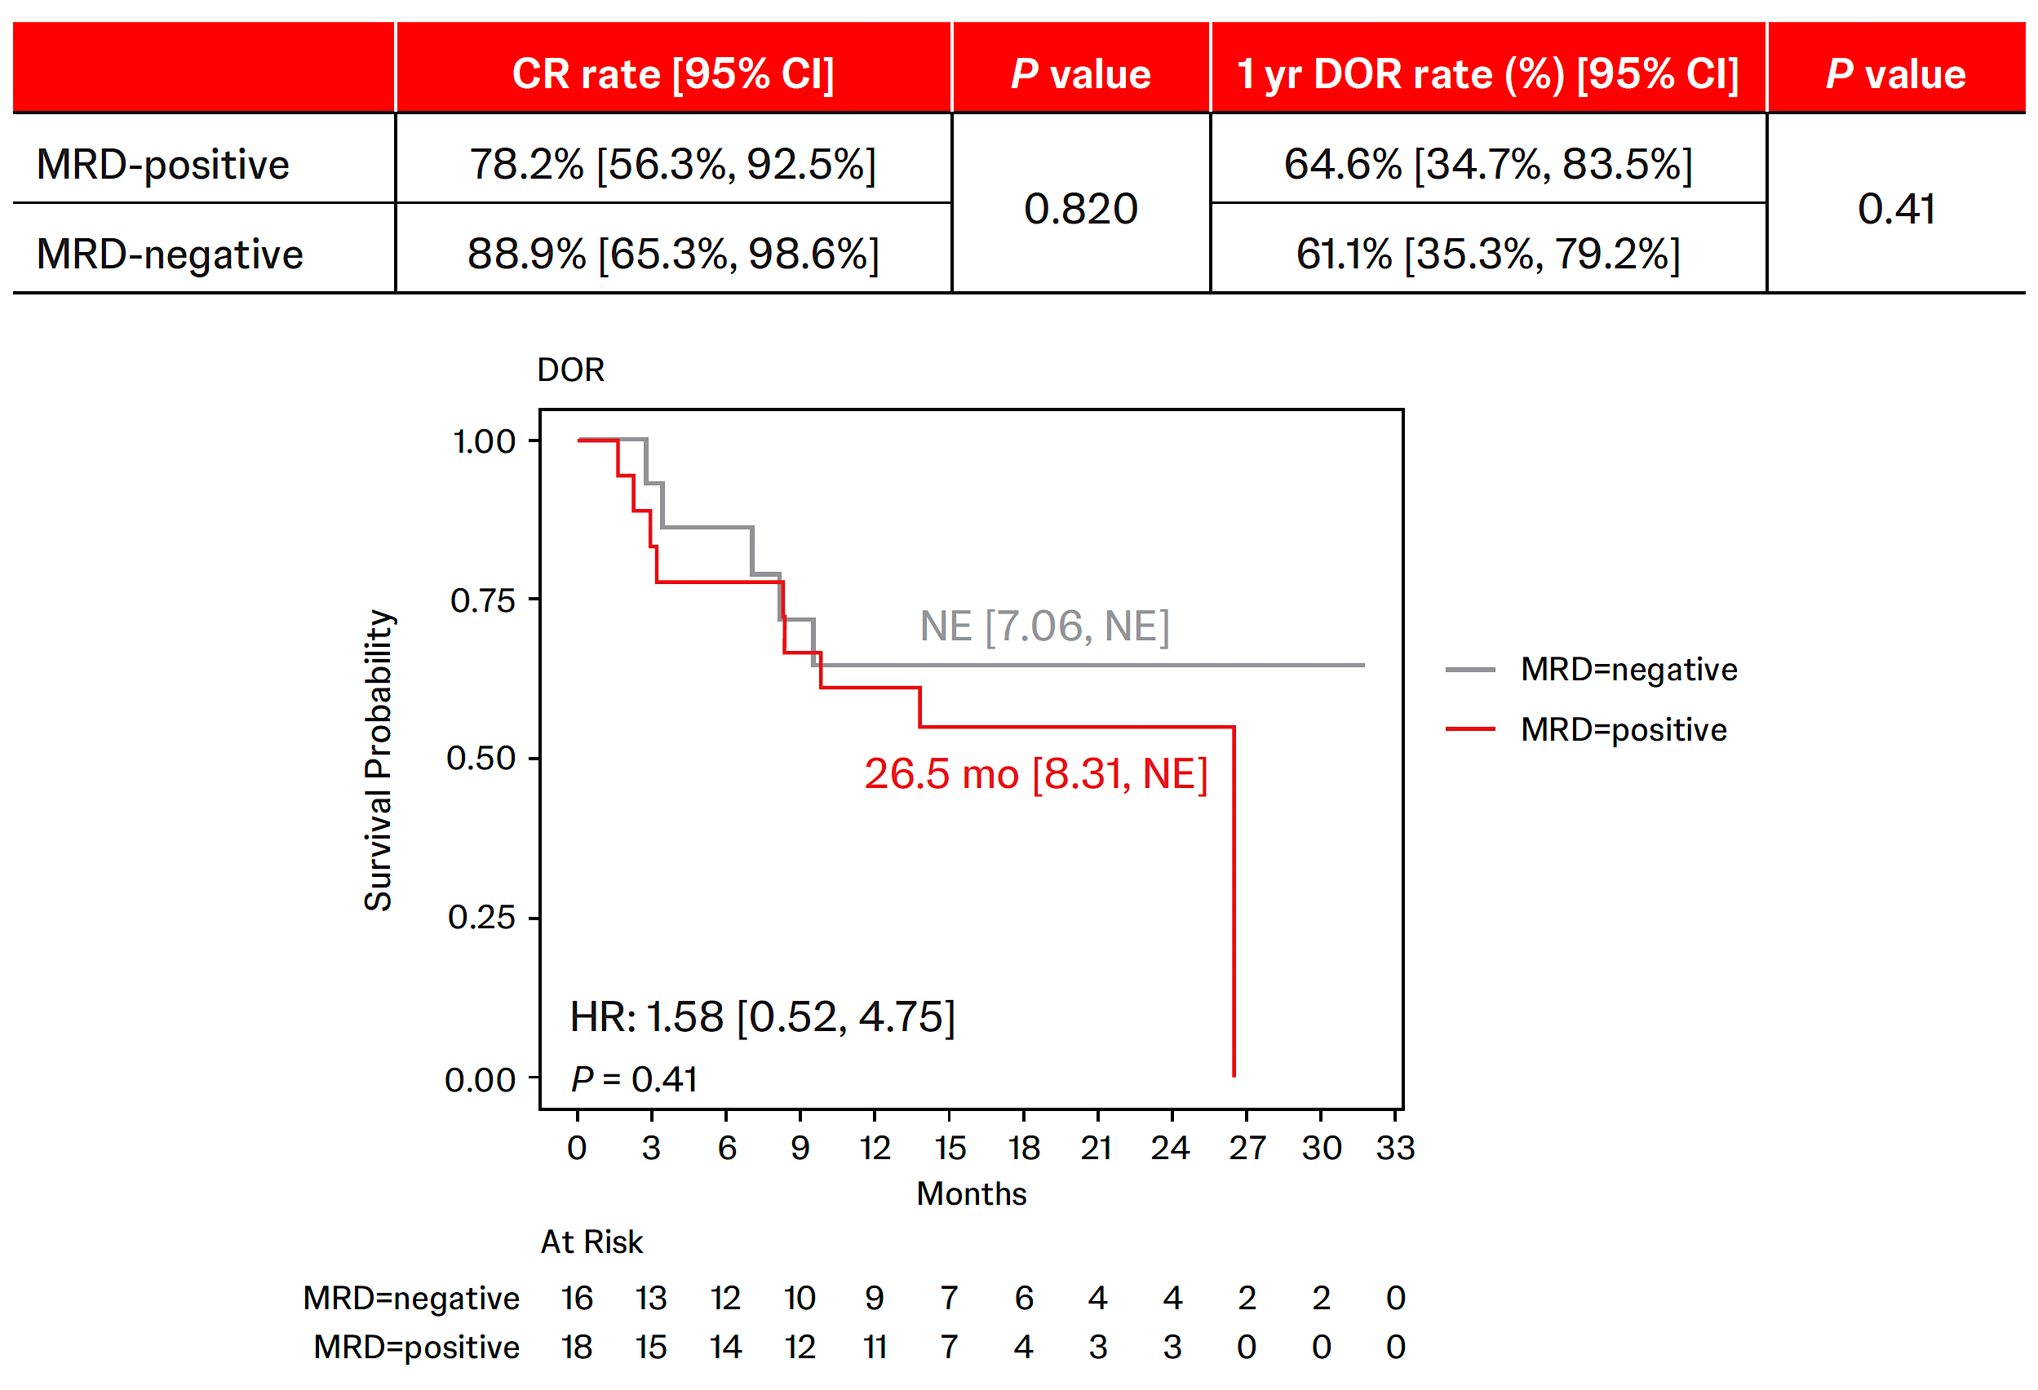
Translational Results With TAR-200 Monotherapy (SR1 – Cohort 2)
PD-L1 and TMB status and association with response
Association of MRD status with response
Guerrero-Ramos F, et al. Presented at European Society for Medical Oncology (ESMO) Congress 2025; Berlin, Germany; October 17–21, 2025

Slide 93
Cohort 4 interim results:
6- and 9-Month DFS Rates With TAR-200 Monotherapy in Papillary Disease–Only HR NMIBC
100
80
6-month DFS rate 85.3%
(95% CI, 71.6-92.7)
9-month DFS rate
81.1%
(95% CI, 66.7-89.7)
60
Patients Without Event,ª %
40
20
0
0
3
6
9
Patients at risk
52
47
Months
40
31
  Median follow-up was 12.8 months
  Median DFS was not reached (95% CI, 12.1-NE)
  Overall, only 5.8% (3 of 52) of patients had RC

Slide 94
SunRISe-3 (NCT05714202) Is a Phase 3, Open-Label, Multicenter Randomized Study
Primary end point
Event-free survival
Time from randomization to first occurrence of:
High-risk disease recurrence
Disease progression^{b}
Any-cause death
For patients with CIS, persistent disease at 6 months is also an EFS event
Key eligibility criteria
Patients with histologically confirmed HR NMIBC (high grade Ta, any T1, or CIS)
BCG naive (no prior BCG or last exposure >3 years prior to randomization)
Group A (n≈350)
TAR-200 + cetrelimabª
1:1:1
(N≈1050)
Group C (n≈350)
TAR-200
Additional criteria:
Aged ≥18 years
ECOG PS of 0, 1, or2
All visible papillary disease must be fully resected (absent) prior to randomization and documented at baseline cystoscopy
Local urine cytology at screening must be negative or atypical for high-grade urothelial carcinoma in patients with papillary-only disease
All adverse events associated with any prior surgery and/or intravesical therapy must have resolved to CTCAE v5.0 grade <2 prior to date of randomization
Secondary end points
Overall CR rate (CIS only)^{c}/duration of CR^{d}
Recurrence-free survival
Time to progression
Overall survival
Cancer-specific survival
Safety and tolerability
Patient-reported outcomes
R
Group B (n≈350)
BCG

Slide 95
SunRISe-5 (NCT06211764) Is an Open-Label, Multicenter
Phase 3 Study
Key eligibility criteria
Histologically confirmed, papillary-only HR NMIBC (high grade Ta or any T1),^{1,2} recurrent within the first year of last dose of BCG
No CIS at time of papillary recurrence
RC refusing or ineligible
ECOG PS <3
Stratification factors
T-stage
Prior BCG
Group A (n≈125)
TAR-200 monotherapy
Q3W during an induction phase
Q12W during a maintenance phase
Primary end point
Disease-free survival
1:1
(N≈250)
Crossover
Patients in Group B may receive TAR-200 after positive study result at any planned analyses
Secondary end points
Recurrence-free survival
Time to next intervention
Time to progression
Time to disease worsening
Overall survival
Safety and tolerability
PROs/HRQoL
R
Group B (n≈125)
Intravesical gemcitabine
OR
Intravesical mitomycin
Weekly during an induction phase
Monthly during a maintenance phase
Disease-free survival is defined as time from randomization to first recurrence of HR NMIBC (high grade Ta, any T1 or CIS), progression, or any cause death, whichever occurs first
The study will evaluate whether TAR-200 will prolong disease-free survival when compared with intravesical chemotherapy in patients with papillary-only HR NMIBC recurrent after BCG therapy who refuse or are unfit for RC

Slide 96

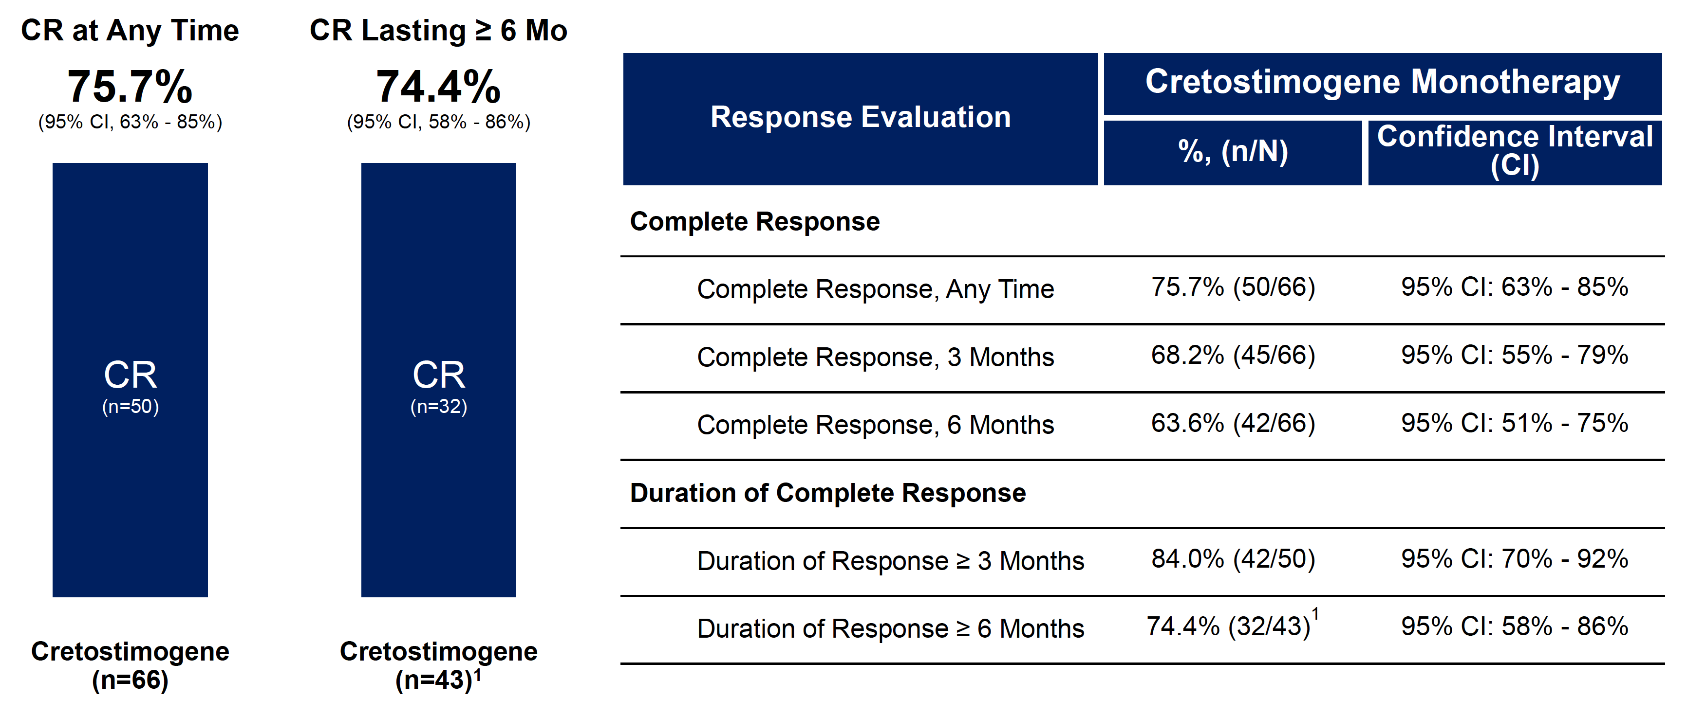
Cretostimogene Grenadenorepvec – BOND-003 Trial
FDA Breakthrough Therapy Designation
US-based clinical trial
76% CR at Any Time; 74.4% of Responders Maintained Response ≥ 6 Months
Tyson MD, et al. AUA 2024

Slide 97
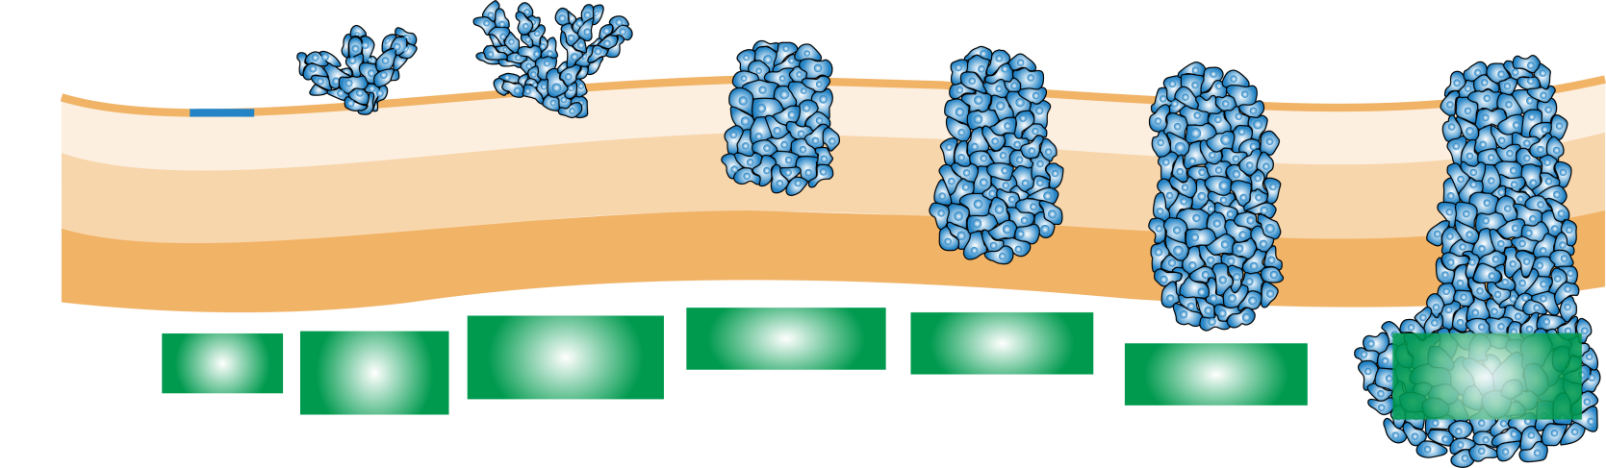

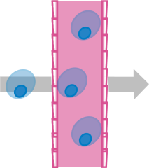
FGFR Mutations Are Frequently Observed in Bladder Cancer¹
Non–Muscle Invasive
Muscle Invasive
Metastatic
>60%
~30%
~30%
~20%
Bladder
lumen
T2a
T2b
T4
T3
Ta
T1
Urothelium
Tis
Lamina
propria
Inner
muscle
Outer
muscle
Tumor invades
subepithelial
connective tissue
Tumor invades
superficial muscle
Tumor invades
deep muscle
Carcinoma
in situ
Noninvasive
papillary
carcinoma
Tumor invades
perivesical tissue
Tumor invades
adjacent tissues
and organs
FGFR inhibitors can be effective across the disease spectrum
1. Knowles MA et al. Nat Rev Cancer. 2015;15:25-41.
97
Notes:
Image source: https://media.springernature.com/full/nature-static/assets/v1/image-assets/nrc3817-f1.jpg

Slide 98
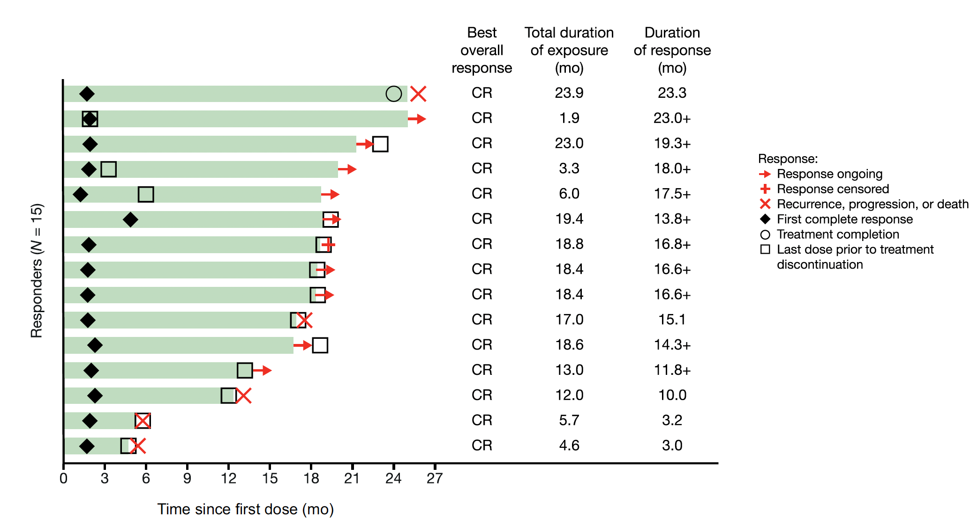
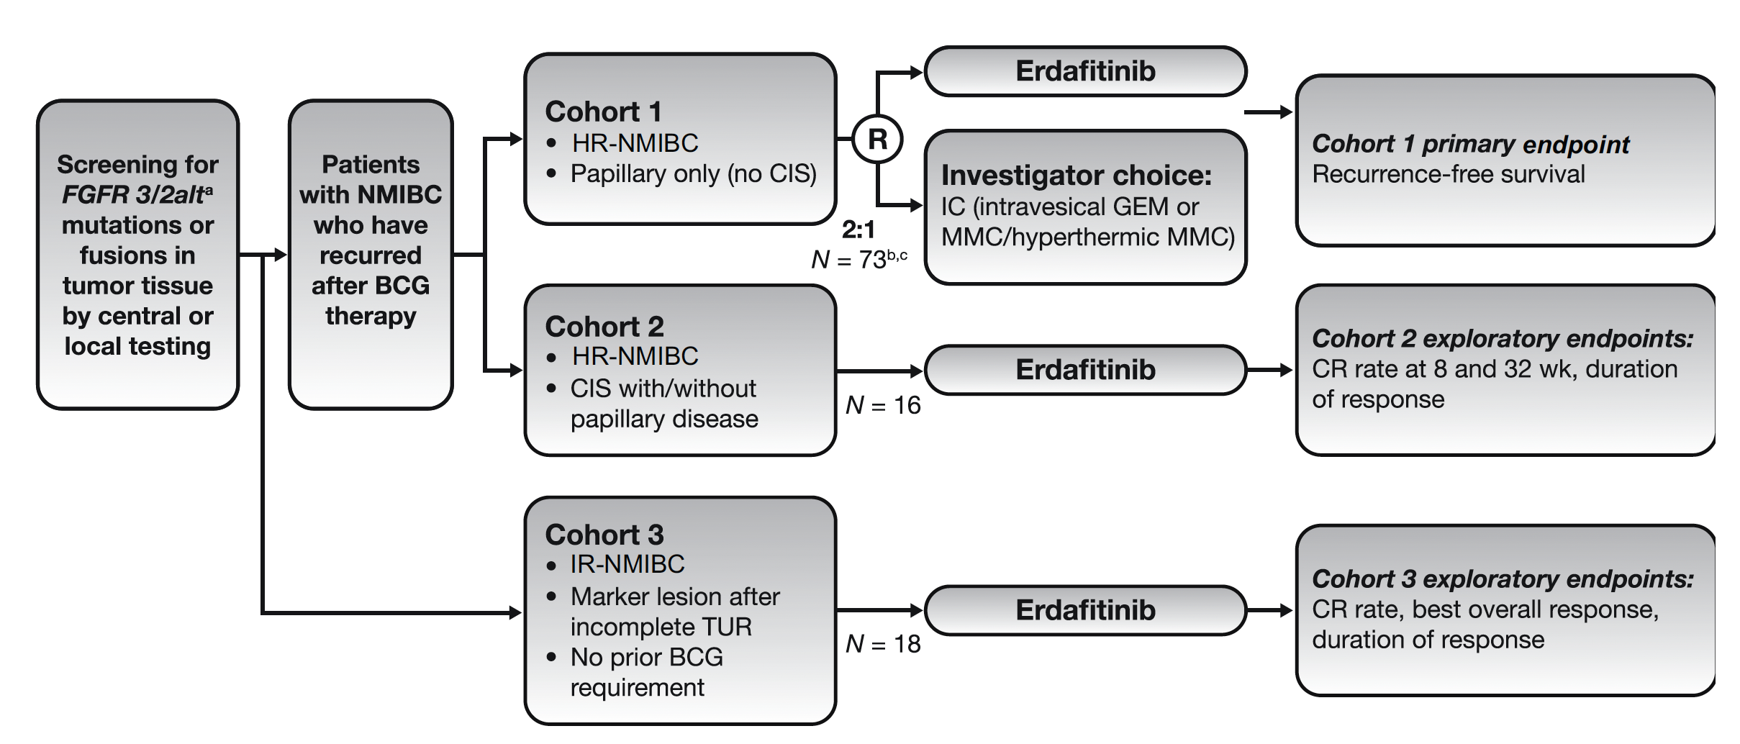
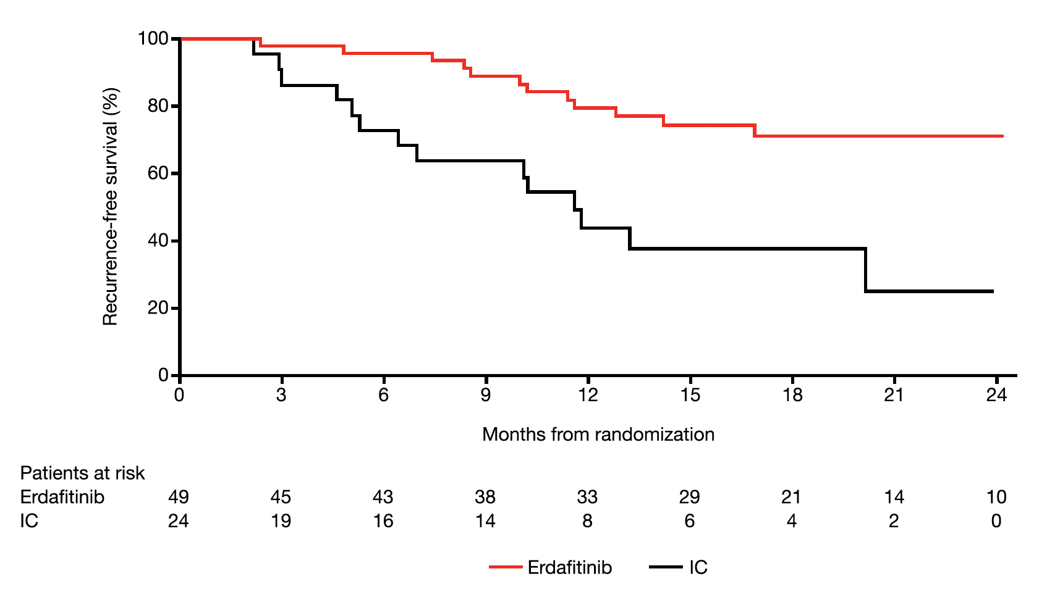
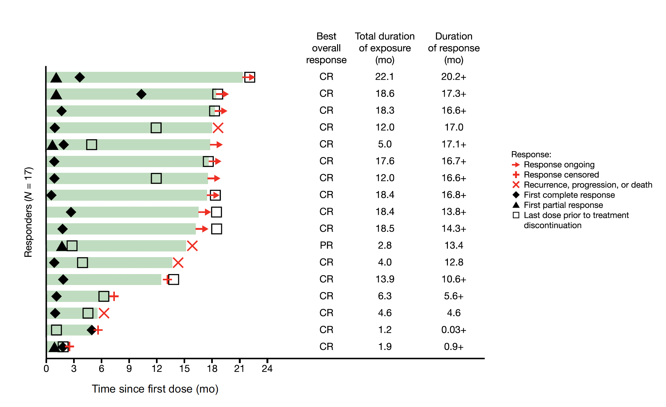
THOR-2: Oral Erdafitinib
Final Results
Cohort 2:
CR (8w): 94%; (32w): 81%
median DoR: 23.3mo
Cohort 3:
CR (3m): 89%
median DoR was NR
Cohort 1
HR: 0.28 (95%CI0.13–0.61); p=0.0007
Daneshmand S et al. Eur Urol. 2026 Feb;89(2):165-173.

Slide 99
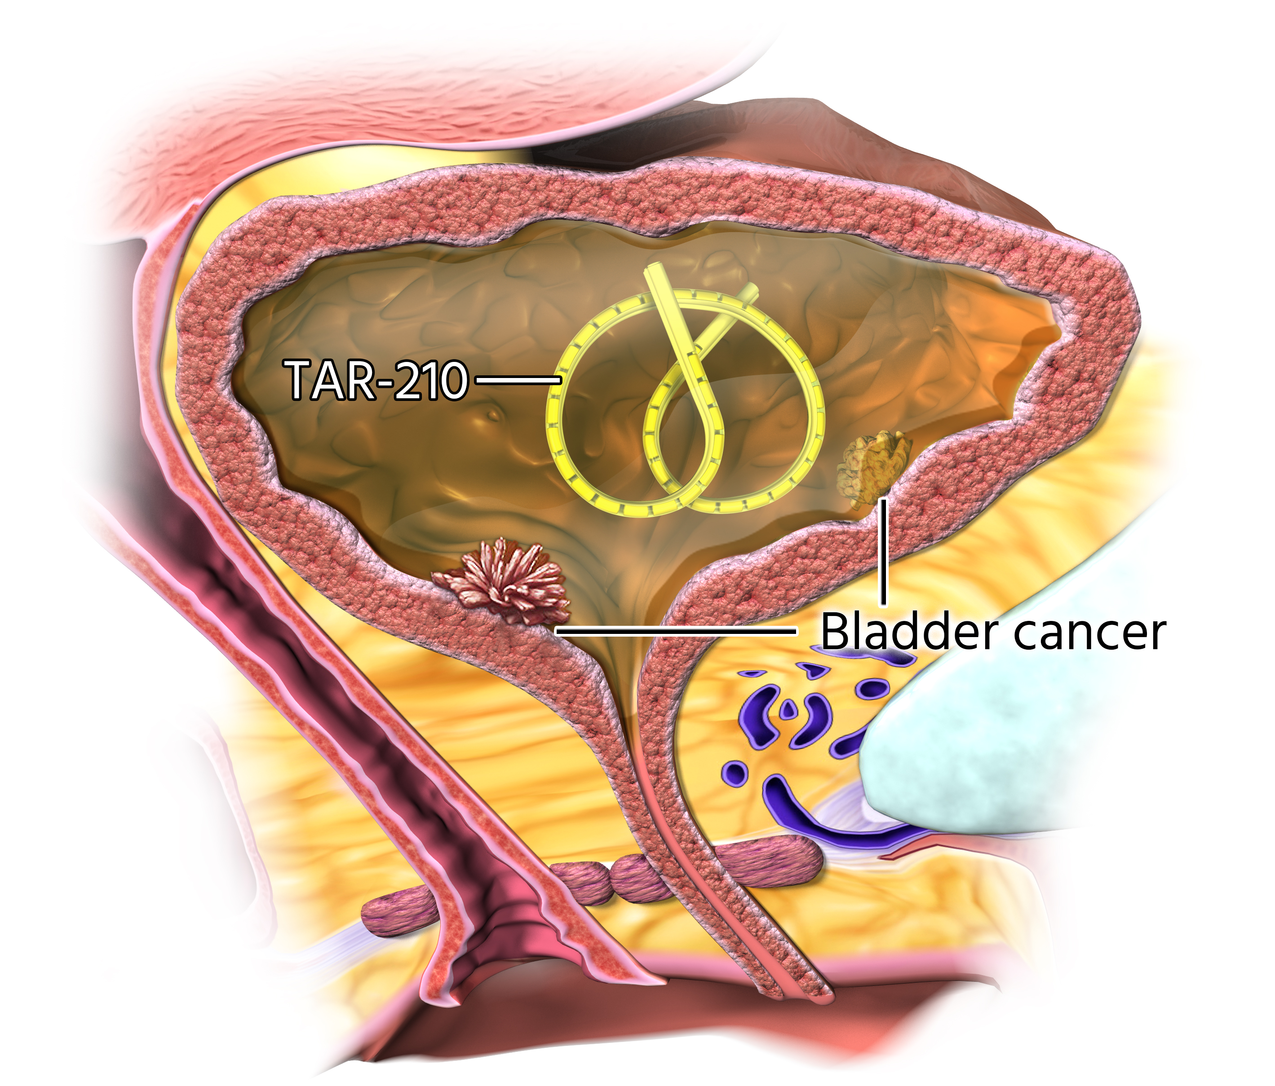
TAR-210 is a Novel Intravesical Targeted Releasing System Designed to Deliver Erdafitinib for Patients With Bladder Cancer
  Despite available treatment options for patients with IR NMIBC, recurrence rates remain high, underscoring the need for effective therapies¹
  FGFR alterations are prevalent in ~50% to 80% of low-grade NMIBC and may function as oncogenic drivers²⁻⁴
  Erdafitinib is a selective pan-FGFR tyrosine kinase inhibitor⁵
    Oral erdafitinib is approved in the United States to treat adults with locally advanced or mUC with susceptible FGFR3 alterations following progression on or after at least 1 prior systemic treatment, with additional approvals across geographies⁶⁻⁹
  Oral erdafitinib demonstrated clinical efficacy in HR and IR NMIBC populations, but was limited by challenging systemic toxicities¹⁰⁻¹²
    In an interim analysis of THOR-2 Cohort 3, 15/18 patients with FGFR-altered IR NMIBC had CR (83%) with median DOR of
    12.8 months¹³
TAR-210 is a novel targeted releasing system designed for sustained local delivery of erdafitinib over 3 months in the bladder
TAR-210 is placed using a urinary placement catheter in
a 2-3 minute in-office procedure.
In a first-in-human study, TAR-210 was well tolerated with promising clinical activity in FGFR-altered HR NMIBC (RFS rate: 82%) and IR NMIBC (CR rate: 87%).¹⁴

Slide 100
TAR-210 First-in-Human Phase 1: Cohorts 1 and 3
Study Design
NCT05316155
HR NMIBC (Cohort 1)
Recurrent, high-grade Ta/T1, papillary only, no CIS
BCG-experiencedª and not undergoing radical cystectomy
TURBT with complete resection of all visible disease prior to treatment
Molecular Eligibility
FGFR alterations:
Flexible molecular eligibility strategy used
  Local or central fresh/ archival tissue-based testing by NGS or PCR
  —or—
  Central urine cell-free DNA NGS testing
Part 1: Dose Escalation
Part 2: Dose Expansion
BOIN^{1,2}
TAR-210-D
~4 mg/day
TAR-210-B
~2 mg/day
Placement every 3 months
IR NMIBC (Cohort 3)
Recurrent, history of low-grade only Ta/T1 disease
Visible target lesions prior to treatment (chemoablation design)
Expansion of both dose levels
Response assessed every 3 months with continued treatment for up to 1 year if recurrence free (Cohort 1) or complete response (Cohort 3).
Clinical cutoff date: March 22, 2024.

Slide 101
TAR-210 HR NMIBC (Cohort 1): Results
HR NMIBC With FGFR Alterations (Cohort 1) (N=21)
  90% estimated 12-month RFS rateª (n=21)
    Median RFS was not estimable
    2 of 21 patients have recurred
    Median duration of follow-up
    8.9 months
  No difference observed in RFS between the TAR-210 dose levels
Duration of RFS (months)
18.10 +
TAR-210-B
~2 mg/day (n=10)
TAR-210-D
~4 mg/day (n=11)
11.99 +
8.97 +
8.97 +
8.97 +
8.94 +
Response
Median duration of treatment with
TAR-210-B, 10.0 months (range, 4-14)
5.98 +
5.85 +
Recurrence free
Recurrence
Assessment
Patients
3.02 +
2.96
15.01 +
14.29 +
9.00 +
Treatment ongoing
Treatment
discontinuation
Treatment completed
Study completed
Follow-up period
9.00 +
8.87 +
7.00 +
3.09 +
Median duration of treatment with
TAR-210-D, 8.9 months (range, 3-12)
3.06 +
3.02 +
2.96
0.03 +
3
6
9
12
15
18
21
Treatment duration in months

Slide 102
TAR-210 IR NMIBC (Cohort 3): Results
IR NMIBC With FGFR Alterations (Cohort 3)
(N=43)ª
  Overall, 31 patients were evaluable for response^{b}
  90% CR rate, with 28/31 patients achieving a CR at Week 12
  Overall, 100% of patients achieved a clinical response; 3 patients had a non-CR/non-PD response
  Consistent CR rate across both doses
  86% (24/28) of CRs are ongoing at time of clinical cutoff
DOR
(months)
TAR-210-B
~2 mg/day (n=21)
TAR-210-D
~4 mg/day (n=22)
14.92 +
12.22
11.99
11.99 +
8.31
6.01 +
6.01 +
5.55 +
3.02 +
Response
3.02 +
3.02 +
2.86 +
CR
Recurrence
Non-CR/Non-PD
Assessment
2.86 +
0.03 +
Patients
Median duration of treatment with
TAR-210-B, 6.8 months (range, 0.6-12)
12.25 +
11.79
8.74 +
8.71 +
Treatment ongoing
Treatment
discontinuation
Treatment completed
Study completed
Study discontinuation
Follow-up period
6.01 +
6.01 +
5.85 +
4.17 +
3.02 +
2.99 +
2.99 +
0.03 +
0.03 +
0.03 +
Durable response rate at specific landmarks^{c} | % (95% CI)
6 months | 100 (100-100)
9 months | 89 (43-98)
Median duration of treatment with
TAR-210-D, 7.6 months (range, 0.6-12)
3
6
9
12
15
18
21
Treatment duration in months

Slide 103
TAR-210 Provided Sustained Erdafitinib Concentrations in Urine With Very Low Plasma Concentrations
Urine Concentration
Plasma Concentration
4000
TAR-210-B, ~2 mg/day (n=25)
TAR-210-D, ~4 mg/day (n=23)
100
TAR-210-B, ~2 mg/day (n=25)
TAR-210-D, ~4 mg/day (n=24)
3500
80
3000
2500
60
Concentration of erdafitinib,
mean (SD), ng/mL
Concentration of erdafitinib,
mean (SD), ng/mL
2000
1500
40
1000
20
500
0
0
1
8
15
29
43
57
90
1
8
15
29
43
57
90
Treatment day (Cycle 1)
Treatment day (Cycle 1)
No hyperphosphatemia was reported, consistent with the very low plasma concentrations observed with TAR-210
Mean plasma erdafitinib concentrations were >50× lower than mean urine concentrations

Slide 104
Safety and Tolerability of TAR-210 in HR NMIBC (Cohort 1) and IR NMIBC (Cohort 3)
  The majority of AEs were grade 1/2 lower urinary tract AEs
  Few patients discontinued due to AEs
    2 patients (3%) discontinued due to TRAEs of low-grade urinary symptoms
  2 patients had serious TRAEs with pyelonephritis and sepsis or UTI and sepsis, respectively
    Both events resolved with antibiotics and patients were able to continue TAR-210
  No dose-limiting toxicities were identified
Patients with events, n (%) | HR NMIBC (Cohort 1) |  | IR NMIBC (Cohort 3) |  | All patients (N=64)
 | TAR-210-B ~2 mg/day (n=10) | TAR-210-D ~4 mg/day (n=11) | TAR-210-B ~2 mg/day (n=21) | TAR-210-D ~4 mg/day (n=22)
≥1 AE | 10 (100) | 9 (82) | 20 (95) | 15 (68) | 54 (84)
≥1 TRAEª | 9 (90) | 5 (55) | 9 (43) | 6 (27) | 30 (47)
Hematuria | 5 (50) | 2 (18) | 7 (33) | 4 (18) | 18 (28)
Dysuria | 4 (40) | 2 (18) | 4 (19) | 2 (9) | 12 (19)
Micturition urgency | 2 (20) | 1 (9) | 5 (24) | 0 | 8 (13)
UTI | 0 | 1 (9) | 3 (14) | 1 (5) | 5 (8)
Urethral pain | 1 (10) | 1 (9) | 1 (5) | 0 | 3 (5)
Cystitis noninfective | 0 | 0 | 1 (5) | 1 (5) | 2 (3)
≥1 TRAE of grade ≥2 | 3 (30) | 3 (27) | 6 (29) | 2 (9) | 14 (22)

Slide 105
MoonRISe-1: An Open-Label, Multicenter, Randomized Phase 3 Study to Evaluate Efficacy and Safety of TAR-210 vs Intravesical Chemotherapy in Patients With
FGFR-Altered, Low-Grade IR NMIBC
Key eligibility criteria
Adults (aged ≥18 years)
Histologically confirmed IR NMIBC
(diagnosed ≤90 days prior to randomization):
  Ta LG/grade 1
    Primary
    Recurrent
  —or—
  Ta LG/grade 2
    Primary
    Recurrent
With ≥1 risk factorª
Susceptible FGFR2/3 alterations by central or local tissue or urine testing
TAR-210
(n≈270)
Q12W for 1 year
Primary end point
Disease-free survival^{b}
1:1
(N≈540)
Secondary end points
Time to next-line treatment
High-grade recurrence-free survival
Progression-free survival
Rate of diagnostic and therapeutic urological interventions
Safety and tolerability
R
Investigator’s choice of intravesical chemotherapy
(n≈270)
MMC or gemcitabine
QW for 4 to 6 doses (induction)
and maintenance for 6 months to 1 year
Stratification factors
Anticipated choice of intravesical chemotherapy
Newly diagnosed vs recurrent disease
Cystoscopic assessment method (white light vs enhanced assessment method)
NCT06319820
  All visible papillary disease must be fully resected prior to randomization
  Assessments of recurrence or progression include urine cytology, cystoscopy, for-cause TURBT or biopsy of bladder lesions, ultrasound, and urography
  The follow-up phase for patients meeting the primary end point is up to ≈5 years

Slide 106
MoonRISe-3: Phase 3 Study of TAR-210 vs Intravesical Chemotherapy in Patients With BCG-treated, FGFR-altered Papillary-only HR NMIBC
Key eligibility criteria
Adults (aged ≥18 years)
Histologically confirmed papillary-only HR NMIBC:
  High-grade Ta
  —or—
  Any T1 (no CIS)
  Recurrent after BCG
  —or—
  Intolerant of BCG
ECOG performance status of ≤2
Susceptible FGFR mutation or fusion by urine or tumor tissue testing
TAR-210
(n≈110)
Q12W for 2 years
Primary end point
Disease-free survivalª
1:1
(N≈220)
Key secondary end points
Recurrence-free survival
Time to next intervention
Time to disease worsening
Time to progression
Overall survival
Safety and tolerability
R
Investigator’s choice of single-agent intravesical chemotherapy
(n≈110)
MMC or gemcitabine
QW for 6 doses (induction) followed by Q4W for 1-2 years (maintenance)
Stratification factors
T stage (high-grade Ta or any T1)
Prior BCG treatment (BCG unresponsive, experienced, or intolerant)
Choice of intravesical chemotherapy
NCT06919965
  Assessments of recurrence or progression will be based on central urine cytology, bladder biopsy, and imaging results
  After a positive interim analysis, the IDMC may recommend a crossover option for patients with recurrence in the intravesical chemotherapy arm

Slide 107
Summary of the Key Efficacy and Safety Outcomes of Novel Therapies for the Treatment of HR NMIBC
Trial | BOND-003¹ | CORE-001² | Sunrise-1³ | Sunrise-1³ | QUILT 3.032⁴ | NCT02773849⁵ | Keynote-057^{6,7} | SWOG S1605⁸
Intervention | Cretostimogene | Cretostimogene + pembrolizumab | TAR-200 | TAR-200 Cetrelimab | N-803+BCG | Nadofaragene | Pembrolizumab | Atezolizumab
Mechanism | Oncolytic immunotherapy | Oncolytic immunotherapy + ICI | Chemotherapy | Chemotherapy + ICI | IL-15 superagonist + BCG | Gene therapy secreting IFN | ICI | ICI
Delivery | Intravesical | Intravesical + intravenous | Intravesical | Intravesical + intravenous | Intravesical | Intravesical | Intravenous | Intravenous
Stage | Phase 3 FDA BTD* | Phase 2 | Phase 2 FDA BTD | Phase 2 | FDA approved April 22, 2024 | FDA approved | FDA approved (CIS) | Phase 2
N | 116 | 35 | 85 | 53 | 77 | 98 | 96 (A) | 129
6m CR-rate | 64% | 82% | N/A | N/A | 56% | 41% | 36% | 27%
12m CR-rate | N/A | 68% | 57.4% | 56.7% | 45% | 24% | 19% (A) | N/A
Safety | 0% G3-4 TRAE | 14.3% G3 TRAE | 9.4% G3-4 TRAE | 35.8% G3-4 TRAE | 16% SAE | 4% G3-4 TRAE | A: 11% G3 TRAE; 2% G4 TRAE | 16% G3-5 TRAE
*BTD: breakthrough therapy designation; ICI: immune-checkpoint inhibitor

Slide 108
BCG-unresponsive CIS: do we measure the IO effect?
2024 2024 2024 2024 2022 2021 2021 2023
Thus far the results favor the intravesical monotherapy strategy
Uncertainties related to the contribution of systemic ICI towards monotherapies
1. Tyson MD et al. AUA 2024. Abstract P2-02. 2. Li R et al. Nat Med. 2024 Aug;30(8):2216-2223. 3. Presented by MS van der Heijden at the European Society of Medical Oncology Congress 2024; September 13-17, 2024; Barcelona, Spain. 4. Chamie K. NEJM Evidence. 2022;2. 5. Boorjian SA et al. Lancet Oncol. 2021;22:107-117. 6. Balar AV et al. Lancet Oncol. 2021 Jul;22:919-930. 7. Necchi A et al. Lancet Oncol. 2024;S1470-2045:00178-5. 8. Black PC et al. Eur Urol. 2023;84:536-544.

Slide 109
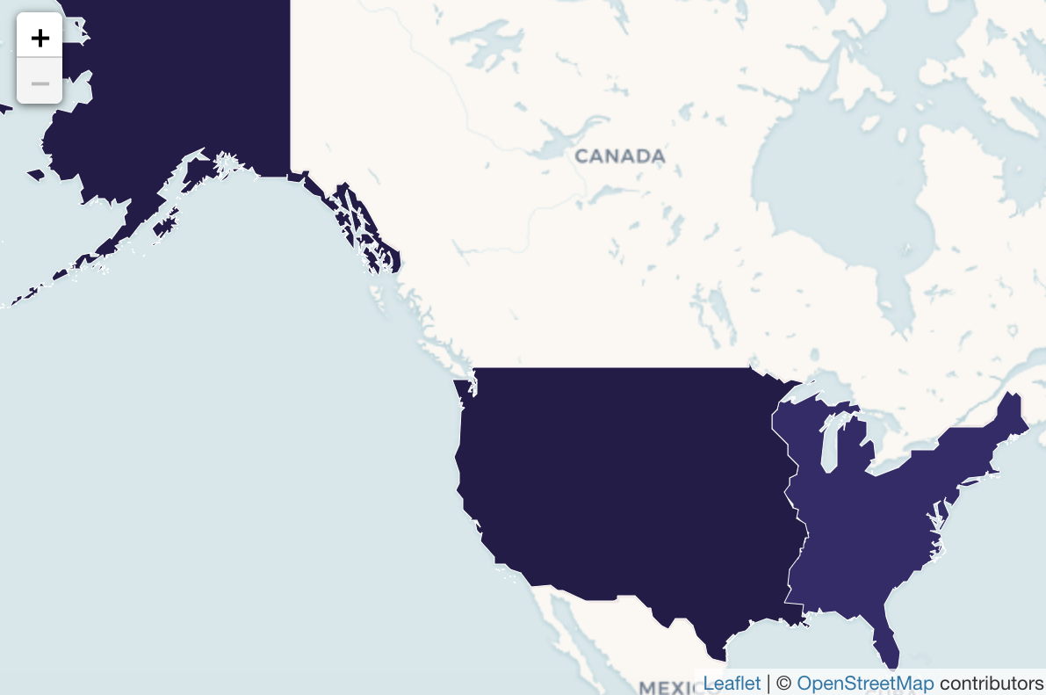
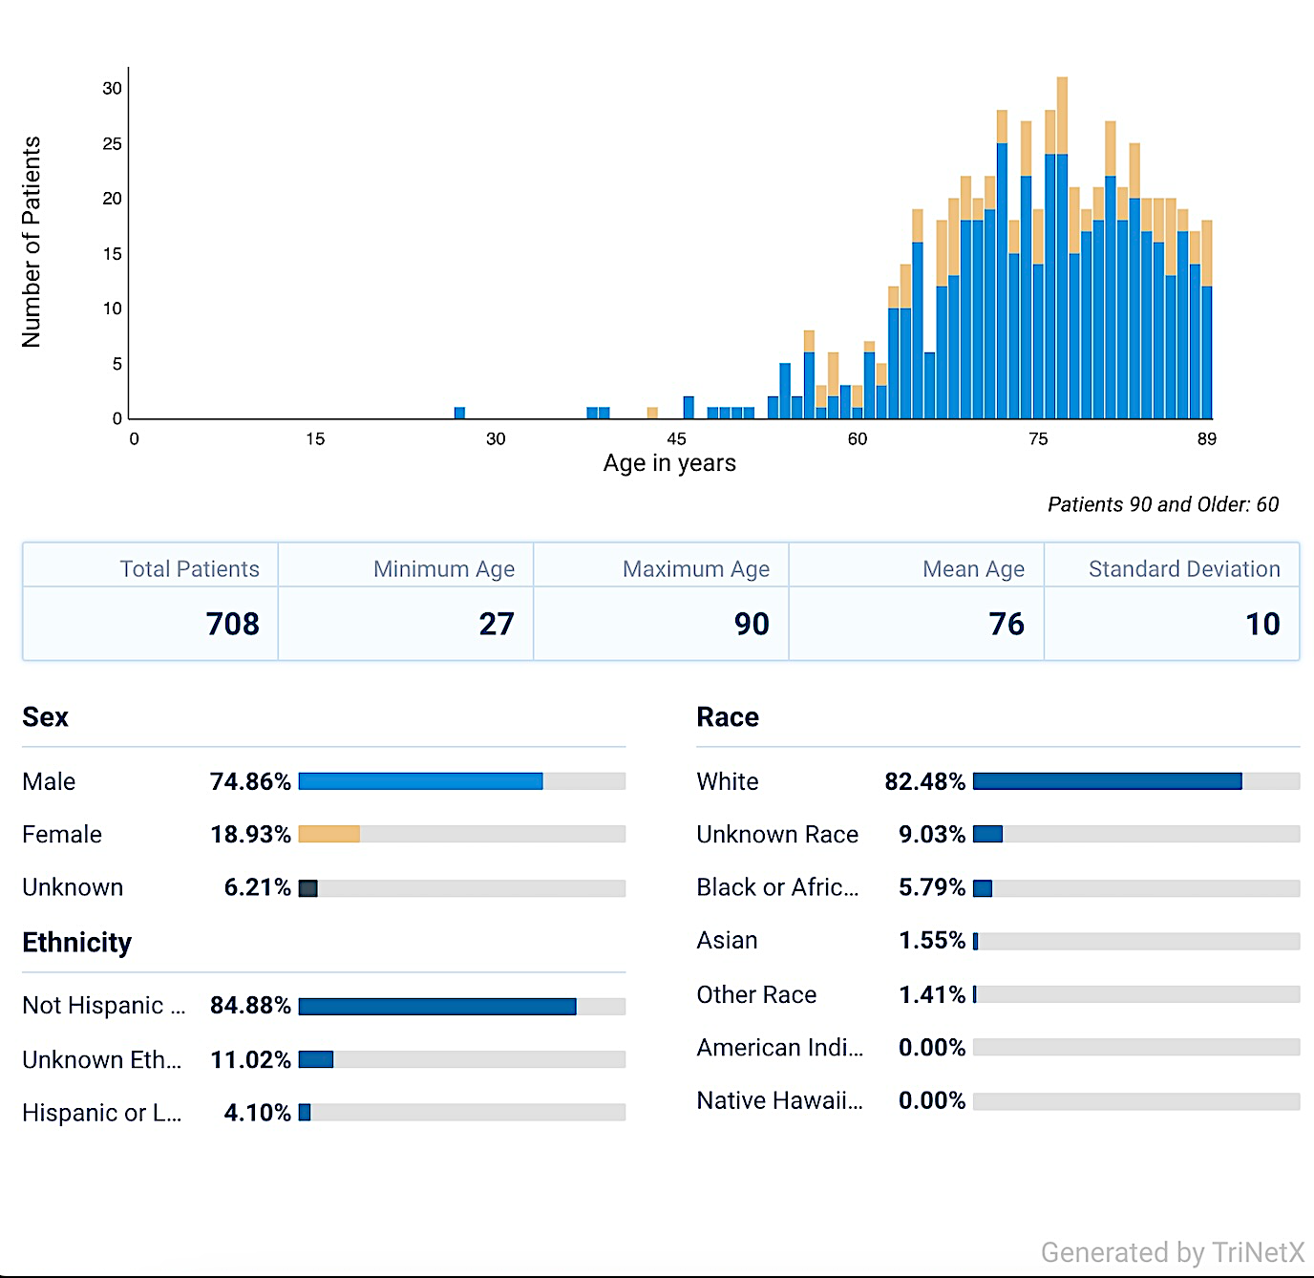
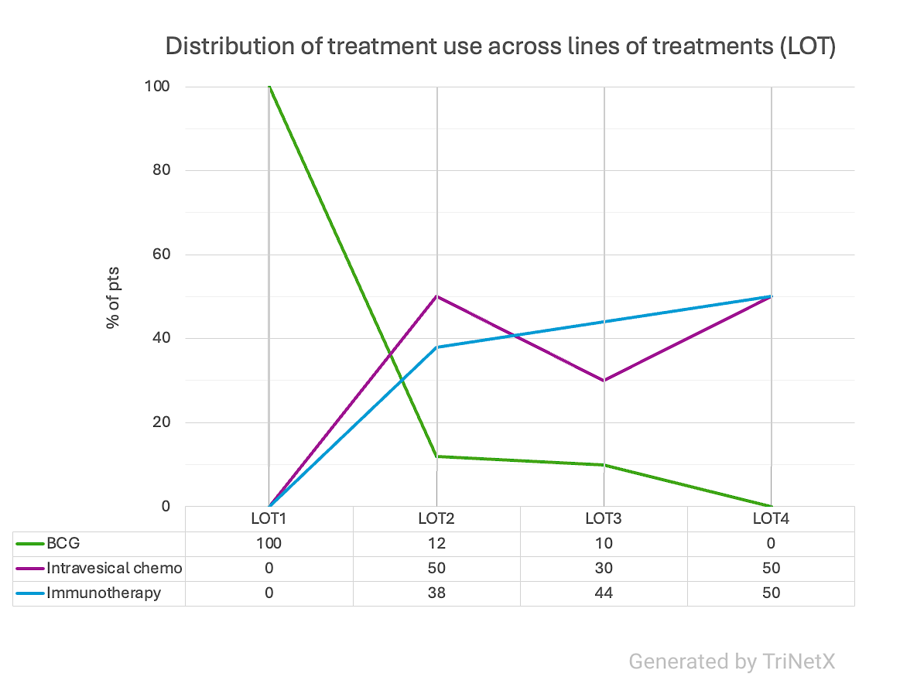
Real world U.S. data of therapeutic pathways for BCG-unresponsive HR-NMIBC
Myers AA, et al. Eur Urol. 2024:
N=36
75% CR rate
12m-DFS: 69%
24m RC-free: 74%
N=708 pts
Source: TrinetX (TirnetX.com); courtesy: Dr. Brigida Maiorano
Contributing sites from USA (see worldmap)

Slide 110
Geographical disparities in radical cystectomy destiny
N-803+BCG
Pembrolizumab
TAR200
Nadofaragene
Cretostimogene
Patient A
BCG rechallenge
(Gem/Doce)
chemoRT
Patient B
BCG rechallenge
(Gem/Doce)
chemoRT

Slide 111
Sunrise-4: Primary results
Necchi A, et al. J Clin Oncol. 2025 Dec 3:JCO2502382. doi: 10.1200/JCO-25-02382. Online ahead of print.
Prof. Andrea Necchi

Slide 112
Evolving treatment landscape for NMIBC
BCG-naive HR-NMIBC: the future of systemic ICI is uncertain based on the results of phase 3 studies
HR-NMIBC unresponsive to BCG: intravesical therapies (e.g., TAR-200, cretostimogene) are best positioned to become the new SOC
Similar to MIBC trials, the contribution of systemic ICI towards the cCR rate is unknown
Patients have raised the bar for therapeutic success: low rates of Grade 3-4 TRAE or long-lasting G1-2 TRAE may count
In general, simplifying the therapeutic burden of these patients is an important goal for the ongoing research
Geographical disparities in therapeutic access (as standard therapy or clinical trial therapy) are huge!

Slide 113
Second Opinion
Elizabeth R Plimack, MD, MS
Neil Love, MD

Slide 114
QUESTIONS FOR THE FACULTY
What would be your most likely treatment approach for this cisplatin-eligible 80-year-old man who develops MIBC and prefers to avoid cystectomy?
Based on the recent FDA approval of neoadjuvant EVP for patients with MIBC who are cisplatin ineligible, how are you integrating this regimen into your clinical practice?
Are you recommending EVP for all patients who are cisplatin ineligible? Have you employed it for patients who are cisplatin eligible? How do you determine the ideal patient to receive this regimen?

Slide 115
QUESTIONS FOR THE FACULTY
How would you assess the tolerability of neoadjuvant EVP? What are the most common side effects experienced by patients who are receiving it?

Slide 116
Second Opinion
Thomas Powles, MBBS, MRCP, MD
Neil Love, MD

Slide 117
QUESTIONS FOR THE FACULTY
Which treatment would you most likely recommend for this man in his late 70s with BCG-refractory CIS? Would you proceed with cystectomy? Would you offer the TAR-200 gemcitabine intravesical system?
Now that the TAR-200 gemcitabine intravesical system has received FDA approval, how are you integrating it into patient care? Which patients do you feel are ideal candidates for this approach?
Based on available data and your clinical experience, how would you compare the tolerability of the TAR-200 gemcitabine intravesical system to that of other available systemic agents?

Slide 118
QUESTIONS FOR THE FACULTY
If the results of the ongoing Phase III SunRISe-3 trial evaluating TAR-200 with cetrelimab or TAR-200 alone versus BCG for patients with treatment-naïve high-risk NMIBC are positive, how do you see this approach being integrated with other available options in this setting?
Would you encourage a patient with FGFR-altered NMIBC in your own practice to enroll on a clinical trial with the TAR-210 erdafitinib intravesical delivery system? Do the early findings with TAR-210 lead you to believe that biomarker-based intravesical therapy is likely to become standard practice in the near future?

Slide 119
Agenda
Module 1: Optimal Use of Anti-PD-1/PD-L1 Antibodies in Non-Muscle-Invasive Bladder Cancer — Dr Friedlander
Module 2: Evolving Management of Muscle-Invasive Bladder Cancer —
Dr Gupta
Module 3: Current and Future Role of Novel Intravesical Therapies in Nonmetastatic Urothelial Bladder Cancer (UBC) — Dr Necchi
Module 4: Emerging Utility of Circulating Tumor DNA Evaluation in Nonmetastatic UBC — Dr Galsky

Slide 120

Emerging Utility of Circulating Tumor DNA (ctDNA) Evaluation in Nonmetastatic UBC
Matthew D. Galsky, MD FASCO
Lillian and Henry Stratton Professor of Medicine
Icahn School of Medicine at Mount Sinai
Director, Genitourinary Medical Oncology
Deputy Director
The Tisch Cancer Center at Mount Sinai
Notes:
Last updated: 28 April 2016

Slide 121
Overview
What do we know?
✅
⚠️
⛔️
ctDNA tells us who needs adjuvant treatment
ctDNA tells us who doesn’t need adjuvant treatment
ctDNA tells us who doesn’t need neoadjuvant treatment

Slide 122
Evolution of ctDNA as a Tool to Assess MRD
1948: cfDNA identified in humans
1977: Higher cfDNA in patients with cancer
1989: identified origin of cfDNA in patients with cancer
1994: tumor-specific (RAS) mutations in plasma of patients with cancer
2008
Mandel P et al. C R Seances Soc Biol Fil. 1948 ;142(3-4):241-3. Leon SA et al. Cancer Res. 1977;37(3):646-50. Stroun M et al. Oncology. 1989;46(5):318-22. Sorenson GD et al. Cancer Epidemiol Biomarkers Prev. 1994;3(1):67-71. Diehl F et al. Nature Medicine. 2008;14:985–990.

Slide 123





Tumor-Informed MRD Testing
Tumour
Resection
C1D1
plasma
C3D1
plasma
  Detect residual disease after surgery
  Monitor response during treatment
ctDNA levels
Adjuvant therapy
C1D1
C3D1
(Median: ≈11 weeks)
(≈6 weeks)
Powles T et al. Nature 2021:595(7867):432-437.

Slide 124
Adjuvant PD-1/PD-L1 Blockade
IMvigor010
NCT02450331
AMBASSADOR
NCT03244384
CheckMate 274
NCT02632409
Atezolizumab
Pembrolizumab
Nivolumab
R
R
R
Observation
Observation
Placebo
Primary endpoint
DFS
Co-primary endpoints
DFS and OS
Primary endpoint
DFS in ITT and PD-L1≥1%
Secondary endpoints
OS, DSS, distant
metastasis-free survival,
AEs and ATAs
Secondary endpoints
OS and DFS in PD-L1+
and PD-L1– patients
Secondary endpoints
OS,
non-urothelial tract RFS, disease-specific survival
Bellmunt J et al. Lancet Oncol. 2021;22(4):525-537. Apolo AB et al. N Engl J Med. 2025; 392(1):45-55. Bajorin DF et al. N Engl J Med. 2021;384(22):2102-2114. Galsky MD et al. J Clin Oncol. 2025;43(1):15-21.

Slide 125
Adjuvant PD-1/PD-L1 Blockade
IMvigor010
NCT02450331
AMBASSADOR
NCT03244384
CheckMate 274
NCT02632409
Atezolizumab
Pembrolizumab
Nivolumab
R
R
R
Observation
Observation
Placebo
Did not meet primary endpoint
Met DFS primary endpoint
Met DFS primary endpoint(s)
Primary endpoint
DFS
Co-primary endpoints
DFS and OS
Primary endpoint
DFS in ITT and PD-L1≥1%
Secondary endpoints
OS, DSS, distant
metastasis-free survival,
AEs and ATAs
Secondary endpoints
OS and DFS in PD-L1+
and PD-L1– patients
Secondary endpoints
OS,
non-urothelial tract RFS, disease-specific survival
Bellmunt J et al. Lancet Oncol. 2021;22(4):525-537. Apolo AB et al. N Engl J Med. 2025; 392(1):45-55. Bajorin DF et al. N Engl J Med. 2021;384(22):2102-2114. Galsky MD et al. J Clin Oncol. 2025;43(1):15-21.

Slide 126
Adjuvant Nivolumab in Patients with MIBC
100
90
80
70
60
Disease-free survival probability (%)
50
40
30
20
10
0
0
6
12
18
24
30
36
42
48
54
60
66
No. at risk
Months
NIVO
279
208
175
147
126
110
92
64
41
28
4
0
PBO
281
159
119
103
90
78
64
52
34
19
3
0
Galsky MD, et al. J Clin Oncol 2025

Slide 127
Adjuvant Nivolumab in Patients with MIBC
100
90
80
70
60
Disease-free survival probability (%)
50
40
30
20
Don’t need adjuvant treatment
10
0
0
6
12
18
24
30
36
42
48
54
60
66
No. at risk
Months
NIVO
279
208
175
147
126
110
92
64
41
28
4
0
PBO
281
159
119
103
90
78
64
52
34
19
3
0
Galsky MD et al. J Clin Oncol. 2025; 43(1):15-21.

Slide 128
Adjuvant Nivolumab in Patients with MIBC
100
90
80
70
60
Disease-free survival probability (%)
50
40
Need adjuvant treatment and benefit
30
20
Don’t need adjuvant treatment
10
0
0
6
12
18
24
30
36
42
48
54
60
66
No. at risk
Months
NIVO
279
208
175
147
126
110
92
64
41
28
4
0
PBO
281
159
119
103
90
78
64
52
34
19
3
0
Galsky MD et al. J Clin Oncol. 2025; 43(1):15-21.

Slide 129
Adjuvant Nivolumab in Patients with MIBC
100
90
80
Need adjuvant treatment but don’t benefit
70
60
Disease-free survival probability (%)
50
40
Need adjuvant treatment and benefit
30
20
Don’t need adjuvant treatment
10
0
0
6
12
18
24
30
36
42
48
54
60
66
No. at risk
Months
NIVO
279
208
175
147
126
110
92
64
41
28
4
0
PBO
281
159
119
103
90
78
64
52
34
19
3
0
Galsky MD et al. J Clin Oncol. 2025; 43(1):15-21.

Slide 130
The “Double Biomarker Dilemma”
Who needs treatment?
Who benefits from treatment?

Slide 131


Retrospective Analysis of ctDNA in IMvigor 010
ctDNA(+) ctDNA(-)
▬ ▬ Atezolizumab
▬ ▬ Observation
ctDNA(−): 63%
HR, 1.31 (95% CI: 0.77, 2.23)
P=0.32
ctDNA(+): 37%
HR, 0.59 (95% CI: 0.41, 0.86)
P=0.0059
ctDNA(−): 63%
HR, 1.14 (95% CI: 0.81, 1.62)
P=0.45
ctDNA(+): 37%
HR, 0.58 (95% CI: 0.43, 0.79)
P=0.0005
Disease-free survival
Overall survival
— n=116
— n=98
— n=184
— n=183
— n=116
— n=98
— n=184
— n=183
Months
Months
Powles T et al. Nature. 2021;595(7867):432-437.

Slide 132

Can ctDNA-Based MRD Serve as an Intermediate Clinical Endpoint?
Powles T et al. Nature. 2021;595(7867):432-437.

Slide 133

Retrospective Analysis of ctDNA in Checkmate 274
Galsky MD et al. Ann Oncol. 2025:S0923-7534(25)04930-0.

Slide 134
IMvigor 011: Study Schema
Powles T et al. N Engl J Med. 2025 Oct 20.

Slide 135
IMvigor 011: ctDNA kinetics
607 patients included in the analysis
459 baseline
ctDNA(-)
148 baseline ctDNA(+)
102 convert to ctDNA(+) during follow-up (22%)
18 developed metastatic disease prior to ctDNA(+) (~4%)

Slide 136
IMvigor 011: Outcomes in patients who tested ctDNA(+)
Powles T et al. ESMO 2025; N Engl J Med. 2025 Oct 20.

Slide 137
IMvigor 011: Outcomes in patients who tested persistently ctDNA(-)
Powles T et al. ESMO 2025; N Engl J Med. 2025 Oct 20.

Slide 138
IMvigor 011: Take Home
Patients with ctDNA(+) assays after radical surgery for urothelial cancer need adjuvant treatment.
Molecular recurrence is a new clinical disease state that can be meaningfully intervened upon with immune checkpoint blockade.
Patients with serial ctDNA(-) assays overall have an excellent prognosis (conditional probability) – one does not know that the assay will be serially negative at the time standard adjuvant decisions need to be made.
Whether treatment upon molecular recurrence is non-inferior to standard adjuvant therapy was not tested…and has not yet been answered.
Powles T et al. ESMO 2025; N Engl J Med. 2025 Oct 20.

Slide 139



Alliance A032103: MODERN

Slide 140

NIAGARA demonstrated an improvement in outcomes adding PD-L1 blockade to neoadjuvant/adjuvant therapy
Powles J et al. N Engl J Med. 2024;391(19):1773-1786.

Slide 141

ctDNA detection rates in NIAGARA
ctDNA+
Baseline
Pre-RC
Post-RC
ctDNA–
Neoadjuvant
Adjuvant
57%
260/460ª
22%
94/422
9%
31/345
BEP
Radical Cystectomy
58%
137/236
19%
40/215
10%
18/184
Durvalumab
55%
123/224
26%
54/207
8%
13/161
Comparator
Powles T et al. ASCO 2025. Abstract 4503.

Slide 142
Prognostic impact of baseline ctDNA in NIAGARA
EFS (combined arms)
EFS (per arm)
1.0
1.0
ctDNA–
0.8
ctDNA–
0.8
ctDNA–
0.6
ctDNA+
0.6
ctDNA+
Probability of EFS
Probability of EFS
ctDNA+
0.4
0.4
0.2
0.2
D+NAC
NAC
0
0
3
6
9
12
15
18
21
24
27
30
33
36
39
42
45
48
51
54
57
60
0
0
3
6
9
12
15
18
21
24
27
30
33
36
39
42
45
48
51
54
57
60
Time from randomization (months)
Time from randomization (months)
No. of patients at risk
ctDNA– D+NAC
ctDNA– NAC
ctDNA+ D+NAC
ctDNA+ NAC
No. of patients at risk
ctDNA–
200 | 197 | 185 | 180 | 174 | 162 | 160 | 158 | 153 | 150 | 146 | 131 | 127 | 104 | 95 | 76 | 60 | 48 | 20 | 10 | 1
260 | 253 | 233 | 206 | 188 | 170 | 156 | 145 | 143 | 135 | 134 | 114 | 105 | 83 | 72 | 61 | 47 | 33 | 16 | 13 | 2
99 | 99 | 91 | 91 | 88 | 84 | 83 | 82 | 80 | 79 | 77 | 69 | 66 | 55 | 51 | 39 | 35 | 29 | 14 | 7 | 1
101 | 98 | 94 | 89 | 86 | 78 | 77 | 76 | 73 | 71 | 69 | 62 | 61 | 49 | 44 | 37 | 25 | 19 | 6 | 3 | 0
137 | 133 | 126 | 113 | 103 | 91 | 85 | 79 | 78 | 75 | 75 | 69 | 63 | 49 | 42 | 35 | 26 | 17 | 7 | 5 | 0
123 | 120 | 107 | 93 | 85 | 79 | 71 | 66 | 65 | 60 | 59 | 45 | 42 | 34 | 30 | 26 | 21 | 16 | 9 | 8 | 2
ctDNA+
ctDNA– vs ctDNA+ | HR, 0.42 (95% CI, 0.30–0.60)
ctDNA–: D+NAC vs NAC | HR, 0.45 (95% CI, 0.24–0.84)
ctDNA+: D+NAC vs NAC | HR, 0.73 (95% CI, 0.51–1.05)
Durvalumab arm = D+NAC; Comparator arm = NAC
Powles T et al. ASCO 2025. Abstract 4503.

Slide 143
Conclusions
What do we know?
✅
⚠️
⛔️
ctDNA tells us who needs adjuvant treatment
ctDNA tells us who doesn’t need adjuvant treatment
ctDNA tells us who doesn’t need neoadjuvant treatment

Slide 144
Second Opinion
Elizabeth R Plimack, MD, MS
Neil Love, MD

Slide 145
QUESTIONS FOR THE FACULTY
What treatment approach would you most likely recommend for a patient who presented with T4 disease and a 2-cm pelvic lymph node and attained a CR on imaging after 6 cycles of EVP?
Would you refer for surgery? Or would you consider this patient to have metastatic disease and use ctDNA to monitor continued response and potentially avoid surgery?

Slide 146
QUESTIONS FOR THE FACULTY
How would you compare the sensitivity of serial ctDNA monitoring to that of radiological assessments in detecting disease progression?
If a patient with no clinical or radiologic evidence of relapse were found to have a positive ctDNA test, would it change your approach to monitoring or management in any way?

Slide 147
Second Opinion
Thomas Powles, MBBS, MRCP, MD
Neil Love, MD

Slide 148
QUESTIONS FOR THE FACULTY
How would you approach the management of this 72-year-old man who received neoadjuvant chemoimmunotherapy and was found to have a positive ctDNA analysis prior to cystectomy and a negative ctDNA result after surgery?
Would you draw from the IMvigor011 results and be more inclined to forgo the use of adjuvant immune checkpoint inhibitor therapy? If so, how often would you repeat ctDNA testing?

Slide 149
QUESTIONS FOR THE FACULTY
Ultimately, do you believe ctDNA will be used to inform treatment decision-making for patients with nonmetastatic UBC in routine clinical practice in the near future?
Outside of a clinical trial, should medical oncologists in community-based practice be ordering these assays for their own patients and acting on the results?

Slide 150
Second Opinion: Clinical Investigators Provide
Perspectives on the Future Role of AKT Inhibition in the Management of Prostate Cancer
A CME Symposium Held Adjunct to the
2026 ASCO® Genitourinary Cancers Symposium
Friday, February 27, 2026
6:00 PM – 7:30 PM PT (9:00 PM – 10:30 PM ET)
Faculty
Professor Karim Fizazi, MD, PhD
Daniel George, MD
Moderator
Elisabeth I Heath, MD

Slide 151
Thank you for joining us!
Your feedback is very important to us.
Please complete the survey currently available via the corresponding QR code on the printed handout for attendees in the room and on Zoom for those attending virtually. The survey will remain open up to 5 minutes after the meeting ends.
How to Obtain CME Credit
In-person attendees: Please refer to the program syllabus for the CME credit link or QR code. Online/Zoom attendees:
The CME credit link is posted in the chat room.

