Slide 1
Expert Second Opinion: Current and Future Roles of Immunotherapy and Targeted Therapy in the
Management of Advanced Gastroesophageal Cancers
A CME Symposium Held Adjunct to the 2026 ASCO® Gastrointestinal Cancers Symposium
Friday, January 9, 2026
6:00 PM – 8:00 PM PT
Faculty
Jaffer A Ajani, MD
Rutika Mehta, MD, MPH
John Strickler, MD
Moderator
Samuel J Klempner, MD

Slide 2




Faculty
Jaffer A Ajani, MD
Professor of Medicine
Department of Gastrointestinal Medical Oncology
Division of Cancer Medicine
The University of Texas
MD Anderson Cancer Center
Houston, Texas
John Strickler, MD
Professor of Medicine
Associate Director, Clinical Research – GI
Co-Leader, Molecular Tumor Board
Duke University
Durham, North Carolina
Rutika Mehta, MD, MPH
Associate Professor
Division of Hematology/Oncology
Weill Cornell Medicine/
NewYork-Presbyterian Hospital
New York, New York
Moderator
Samuel J Klempner, MD
Program Director, Gastroesophageal Cancers
Tobins Family Endowed Chair in Esophagogastric Cancer
Massachusetts General Hospital
Associate Professor, Harvard Medical School
Boston, Massachusetts

Slide 3
Dr Ajani — Disclosures
Faculty
Advisory Committees and Consulting Agreements | AstraZeneca Pharmaceuticals LP, BeOne, Bristol Myers Squibb, Daiichi Sankyo Inc, Gilead Sciences Inc, Henlius, Jazz Pharmaceuticals Inc, Merck, Taiho Oncology Inc, Zymeworks Inc
Contracted Research | AstraZeneca Pharmaceuticals LP, BeOne, Bristol Myers Squibb, Henlius, I-Mab Biopharma, Jazz Pharmaceuticals Inc, Merck, Servier Pharmaceuticals LLC

Slide 4
Dr Ilson — Disclosures
Faculty
Advisory Committees | Amgen Inc, Astellas, AstraZeneca Pharmaceuticals LP, Bayer HealthCare Pharmaceuticals, Bristol Myers Squibb, Daiichi Sankyo Inc, Lilly, Merck, Oncolys BioPharma, Roche Laboratories Inc, Taiho Oncology Inc
Consulting Agreements | Astellas

Slide 5
Dr Mehta — Disclosures
Faculty
Advisory Committees | Amgen Inc, Astellas, AstraZeneca Pharmaceuticals LP, BeOne, Bristol Myers Squibb, Daiichi Sankyo Inc, Eisai Inc, Gilead Sciences Inc, GSK, Jazz Pharmaceuticals Inc, Legend Biotech
Consulting Agreements | Jazz Pharmaceuticals Inc, Lilly, Replimune
Data and Safety Monitoring Boards/Committees | Arcus Biosciences, Gilead Sciences Inc
Nonrelevant Financial Relationships | Robert A Winn Career Development Award

Slide 6
Dr Strickler — Disclosures
Faculty
Advisory Committees | AbbVie Inc, Amgen Inc, Astellas, AstraZeneca Pharmaceuticals LP, Bayer HealthCare Pharmaceuticals, BeOne, Boehringer Ingelheim Pharmaceuticals Inc, Bristol Myers Squibb, Cytovation ASA, Daiichi Sankyo Inc, GE Healthcare, Genentech, a member of the Roche Group, GSK, Incyte Corporation, Ipsen Biopharmaceuticals Inc, Jazz Pharmaceuticals Inc, Johnson & Johnson, Leap Therapeutics Inc, Lilly, Merck, Natera Inc, Pfizer Inc, Pheon Therapeutics, Quanta Therapeutics, Regeneron Pharmaceuticals Inc, Sanofi, Taiho Oncology Inc, Takeda Pharmaceuticals USA Inc, Triumvira Immunologics, Xilio Therapeutics
Contracted Research | AbbVie Inc, Amgen Inc, Apollo Therapeutics, Bayer HealthCare Pharmaceuticals, BeOne, Daiichi Sankyo Inc, Genentech, a member of the Roche Group, GSK, Leap Therapeutics Inc, Lilly, Novartis, Pfizer Inc, Quanta Therapeutics, Revolution Medicines
Data and Safety Monitoring Boards/Committees | AbbVie Inc, Johnson & Johnson
Stock Options — Private Companies | Triumvira Immunologics

Slide 7
Dr Klempner — Disclosures
Moderator
Advisory Committees | Amgen Inc, Astellas, AstraZeneca Pharmaceuticals LP, Boehringer Ingelheim Pharmaceuticals Inc, Bristol Myers Squibb, Daiichi Sankyo Inc, Eisai Inc, Elevation Oncology, Gilead Sciences Inc, I-Mab Biopharma, Merck, Mersana Therapeutics Inc, Natera Inc, Novartis, Pfizer Inc, Taiho Oncology Inc
Consulting Agreements | Astellas, Novartis (ended 2023)
Stock Options — Private Companies | MBrace Therapeutics
Nonrelevant Financial Relationships | Debbie’s Dream Foundation, Degregorio Family Foundation, Gastric Cancer Foundation, Gateway for Cancer Research, National Cancer Institute/National Institutes of Health, NCCN (member of Gastric and Esophageal Guidelines Committees), Stand Up 2 Cancer/AACR, Torrey Coast Foundation

Slide 8
Commercial Support
This activity is supported by educational grants from Astellas, BeOne, Gilead Sciences Inc, and Jazz Pharmaceuticals Inc.
Research To Practice CME Planning Committee Members,
Staff and Reviewers
Planners, scientific staff and independent reviewers for Research To Practice have no relevant conflicts of interest to disclose.

Slide 9
This educational activity contains discussion of
non-FDA-approved uses of agents and regimens. Please refer to official prescribing information for each product for approved indications.

Slide 10

Save The Date
A Multitumor CME/MOC-, NCPD- and ACPE-Accredited Educational Conference Developed in Partnership with Florida Cancer Specialists & Research Institute
Friday to Sunday, April 24 to 26, 2026
The Ritz-Carlton Orlando, Grande Lakes | Orlando, Florida
Moderated by Neil Love, MD

Slide 11
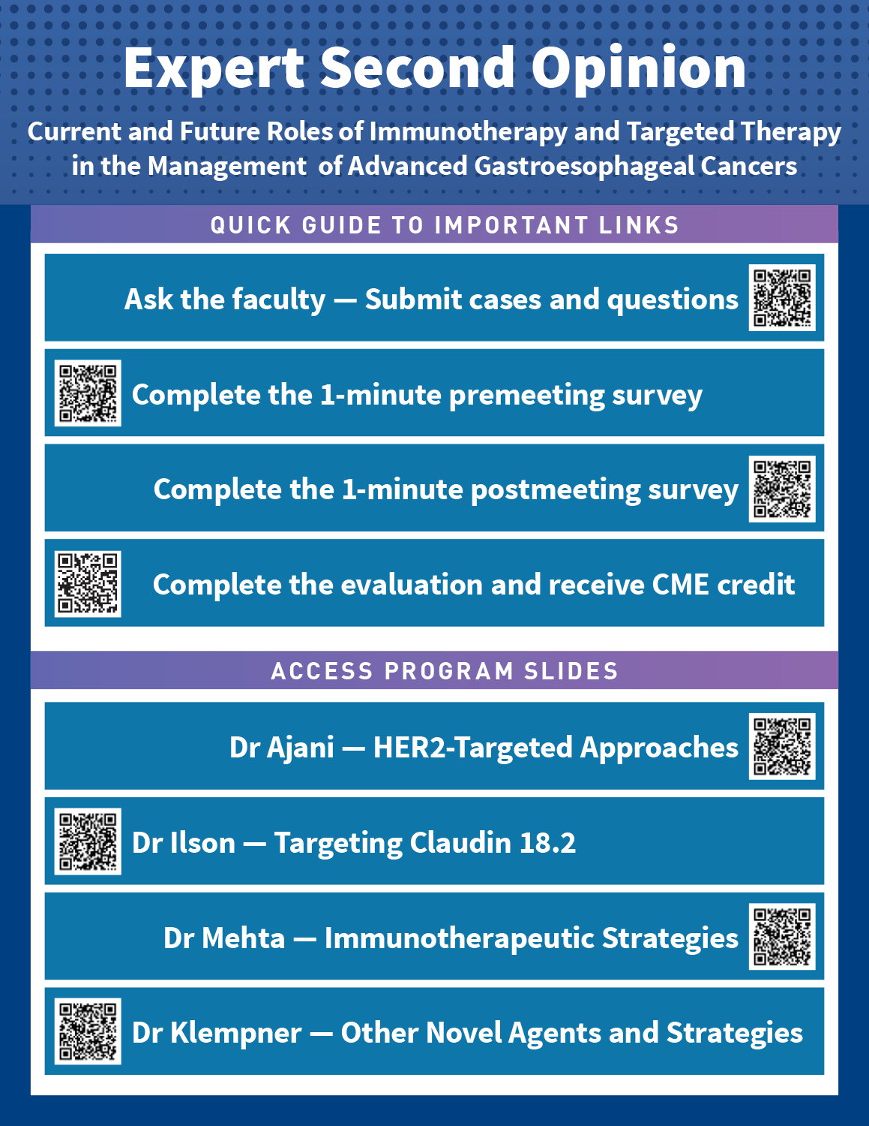




Clinicians in the Meeting Room
Please refer to the printed handout provided with your meeting syllabus, and scan the corresponding QR code to
Review and Download Program Slides.
Answer Survey Questions: Complete the pre-
and postmeeting surveys.
Ask a Question: We will aim to address as many questions as possible during the program.
Get CME Credit: Complete the course evaluation.
Notes:
11

Slide 12
Clinicians Attending via Zoom
Review Program Slides: A link to the program slides will be posted in the chat room at the start of the program.
Answer Survey Questions: Complete the pre- and postmeeting surveys.
Ask a Question: Submit a challenging case or question for discussion using the Zoom chat room.
Get CME Credit: A credit link will be provided in the chat room at the conclusion of the program.
Notes:
12

Slide 13
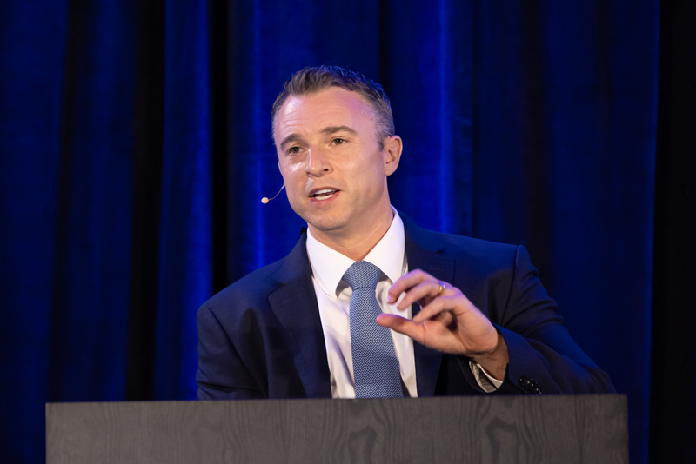
About the Enduring Program
The live meeting is being video
and audio recorded.
The proceedings from today will
be edited and developed into
an enduring web-based
program.
An email will be sent to all attendees when the activity is available.
To learn more about our education programs, visit our website, www.ResearchToPractice.com
Notes:
13
13

Slide 14
Expert Second Opinion: Current and Future Roles of Immunotherapy and Targeted Therapy in the
Management of Advanced Gastroesophageal Cancers
A CME Symposium Held Adjunct to the 2026 ASCO® Gastrointestinal Cancers Symposium
Friday, January 9, 2026
6:00 PM – 8:00 PM PT
Faculty
Jaffer A Ajani, MD
Rutika Mehta, MD, MPH
John Strickler, MD
Moderator
Samuel J Klempner, MD

Slide 15
Agenda
Module 1: HER2-Targeted Approaches for Advanced Gastroesophageal Cancers — Dr Ajani
Module 2: Targeting Claudin 18.2 in Advanced Gastroesophageal Cancers —
Dr Strickler
Module 3: Optimal Incorporation of Immunotherapeutic Strategies into Treatment for Patients with Metastatic Gastroesophageal Tumors —
Dr Mehta
Module 4: Other Novel Agents and Strategies Under Evaluation for Advanced Gastroesophageal Cancers — Dr Klempner

Slide 16
Survey of 50 Community-Based
General Medical Oncologists
December 22, 2025 – January 7, 2026

Slide 17
Agenda
Module 1: HER2-Targeted Approaches for Advanced Gastroesophageal Cancers — Dr Ajani
Module 2: Targeting Claudin 18.2 in Advanced Gastroesophageal Cancers —
Dr Strickler
Module 3: Optimal Incorporation of Immunotherapeutic Strategies into Treatment for Patients with Metastatic Gastroesophageal Tumors —
Dr Mehta
Module 4: Other Novel Agents and Strategies Under Evaluation for Advanced Gastroesophageal Cancers — Dr Klempner

Slide 18
Her2-Targeting Therapeutics for Advanced Gastroesophageal Cancers
Recent Developments
Jaffer A. Ajani January 08, 2026

Slide 19
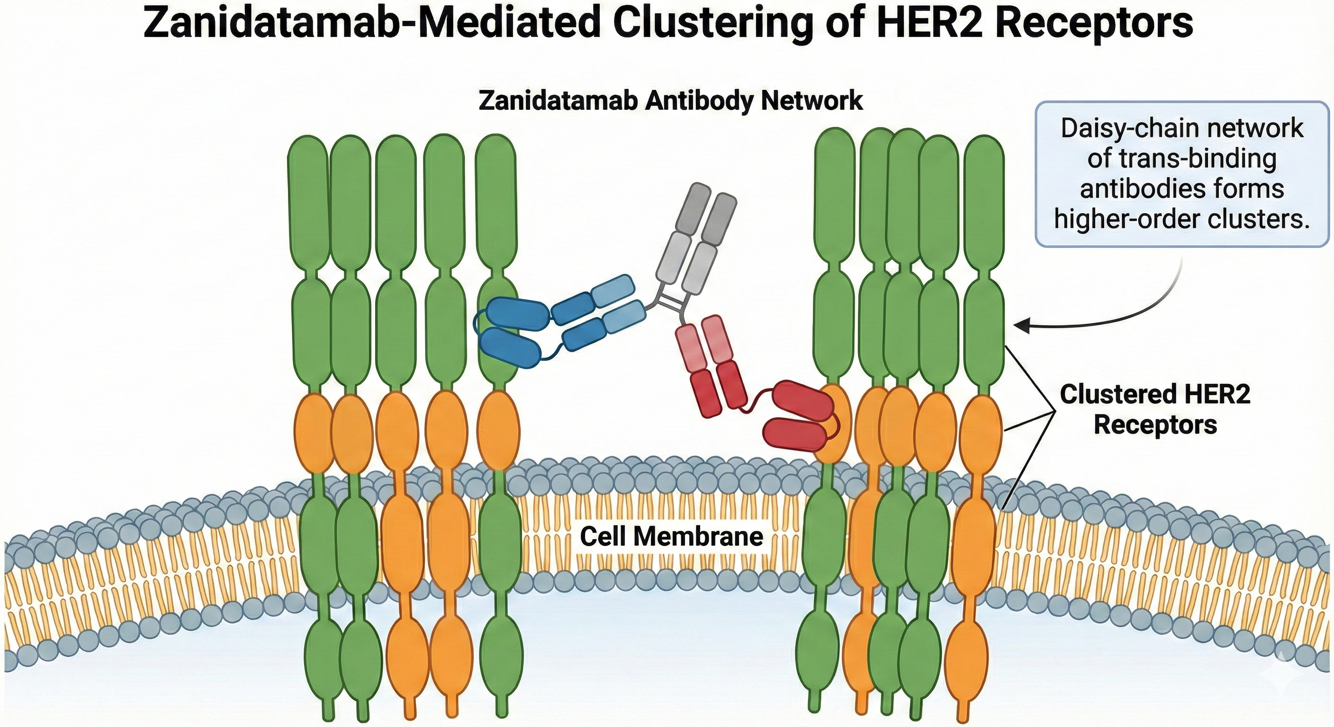

Slide 20
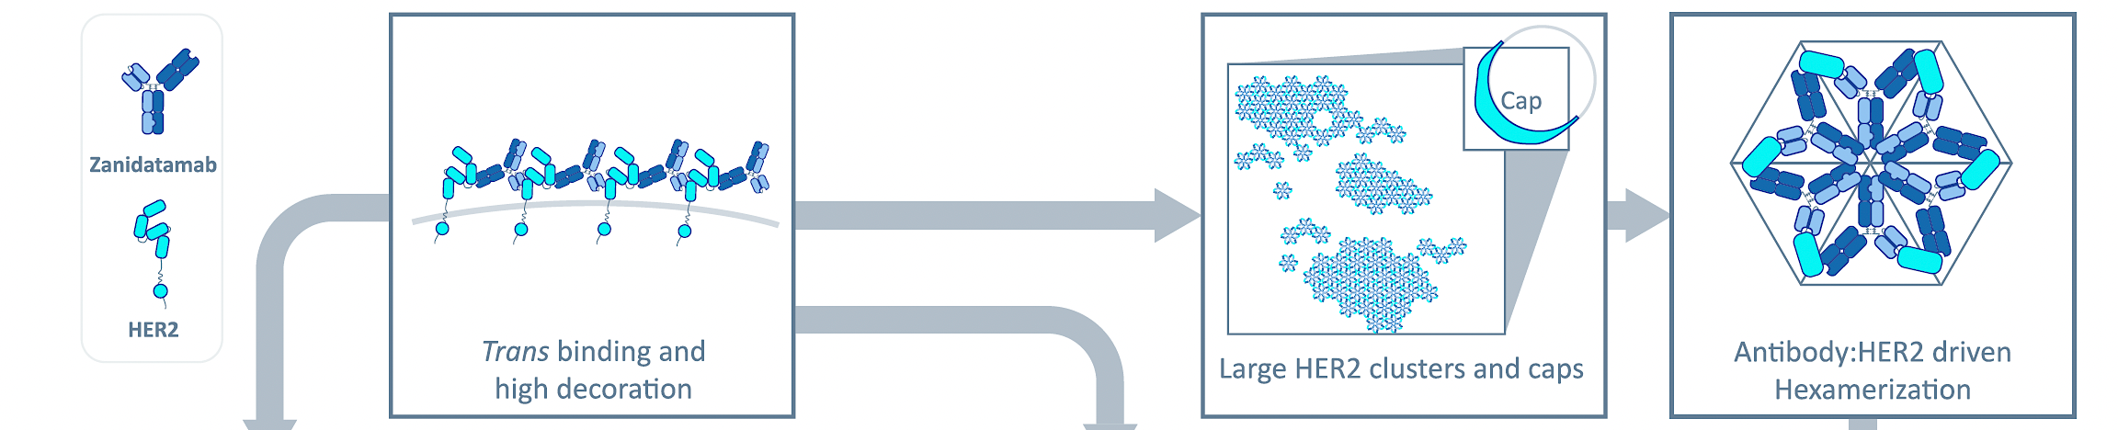
Consequences of Zani binding Her2 receptor

Slide 21
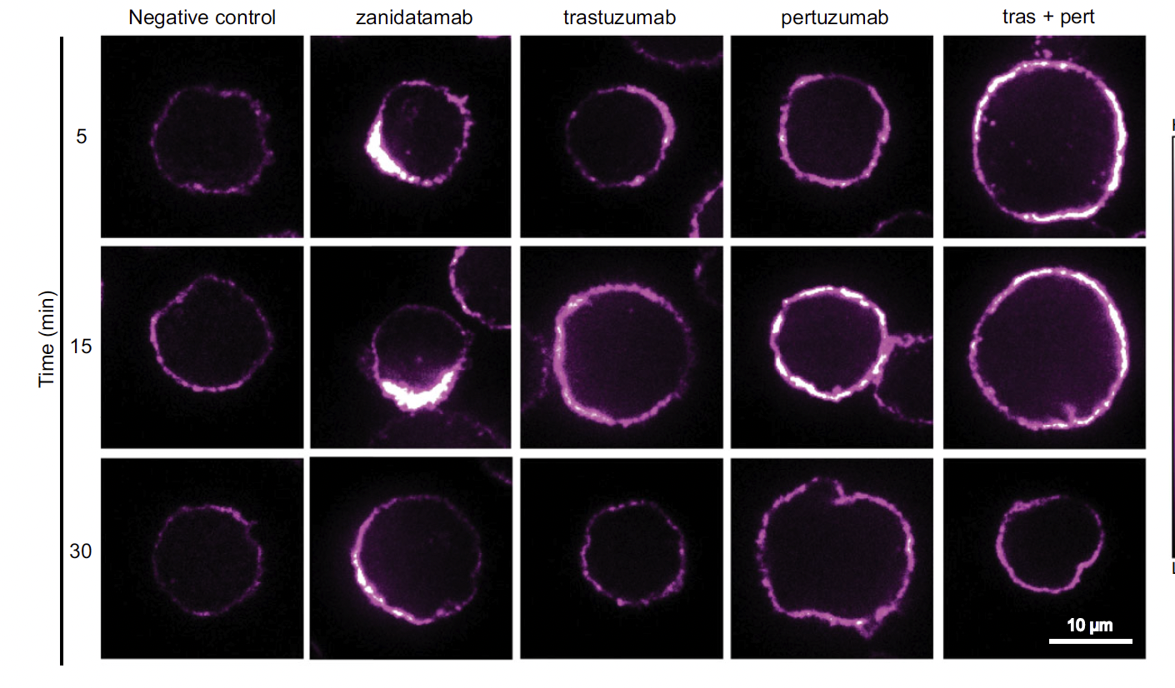
Zani forming “Caps” compared to others
NC 2023

Slide 22
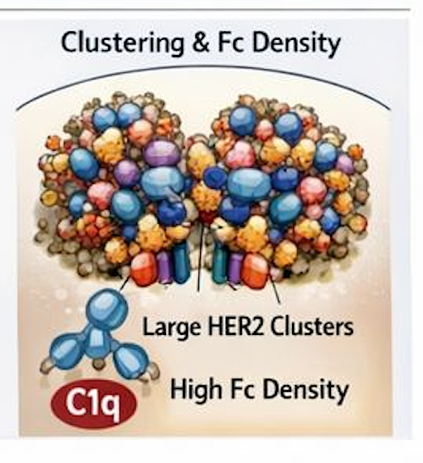

Slide 23
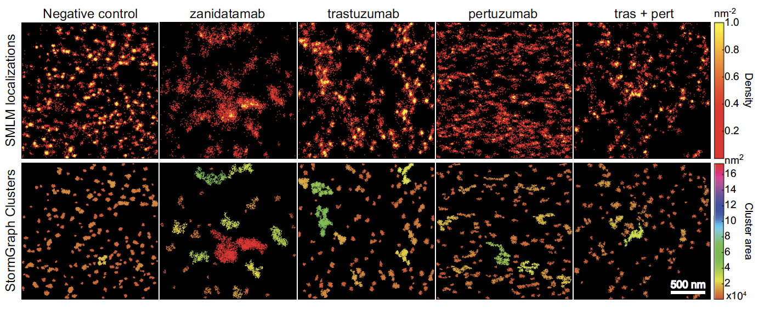
Zani-induced Clustering compared to others
SMLM, single molecule localization microscopy
dSTORM, Stochastic optical reconstruction microscopy
NC 2023

Slide 24
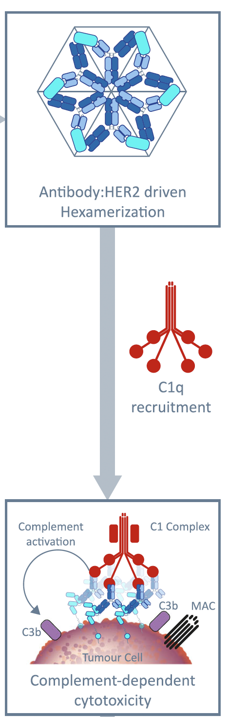
Hexamerization attracts key CDC protein, C1q
C1q cannot recruit other C3 members unless 6 FC domains are exposed
CDC is unique to Zani

Slide 25
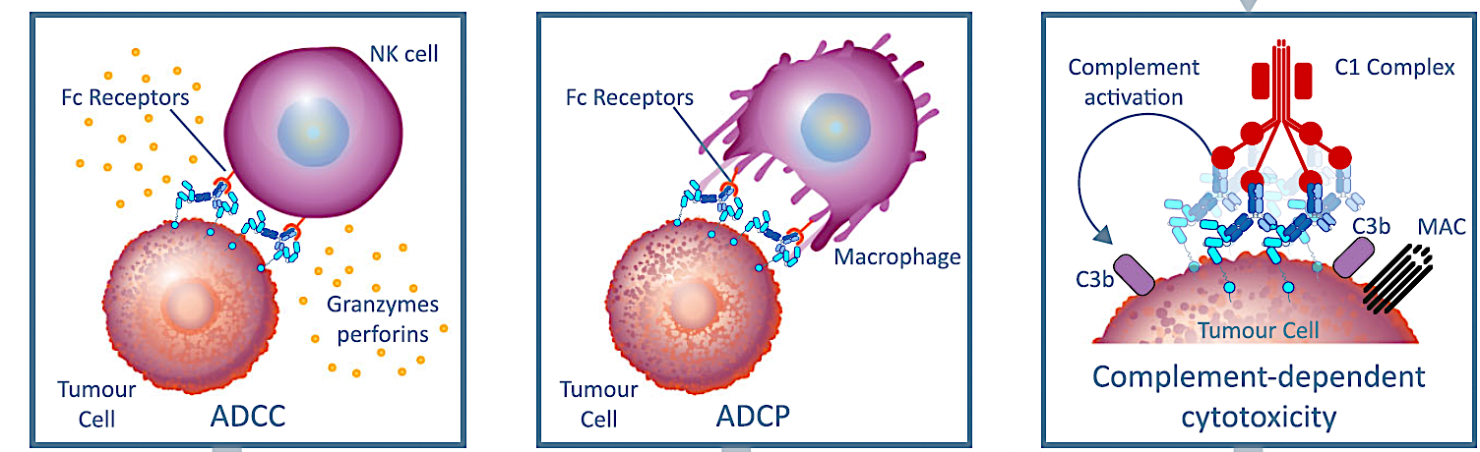
Zani-induced immune-mediated cancer cell killing

Slide 26
Summary of Zanidatamab’s effects on engaging Her2 receptors
Engages Her2 in TRANS configuration leading to extensive, ordered, receptor clustering (or lattice) on cancer cell membrane
Reorganizes the Her2 receptor landscape (staples Her2 receptor) forming Her2 receptor caps
High avidity. Ordered complexes are stable. Forming a ring structure (receptor/Zani). Clusters project Fc domains critical for C1q engagement.
Major CDC effects. Formation of MACs (membrane attack complexes). MACs cause cell membrane pores and osmolytic lysis of cancer cells (independent of the immune system).
Cross-linked cluster promotes internalization (endocytosis) and trafficking away from endosomes (which cannot handle large size) to lysosomes (preventing recycling). Depletes Her2 density and biogenesis.
Blocks other oncogene activation (ERK/AKT/EGFR, others)

Slide 27
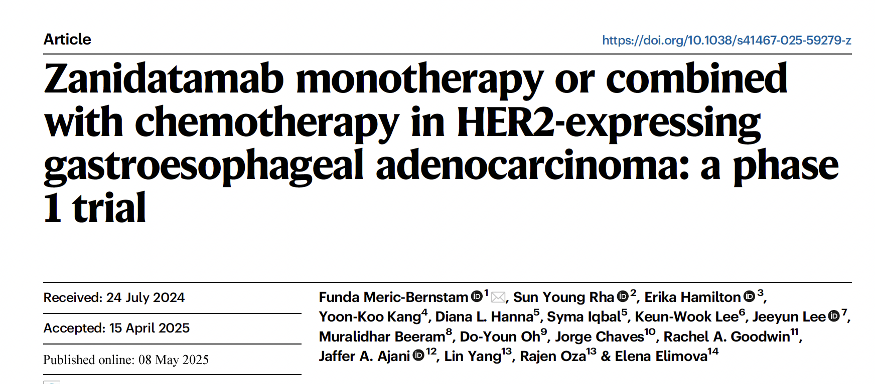
Nat Communication

Slide 28
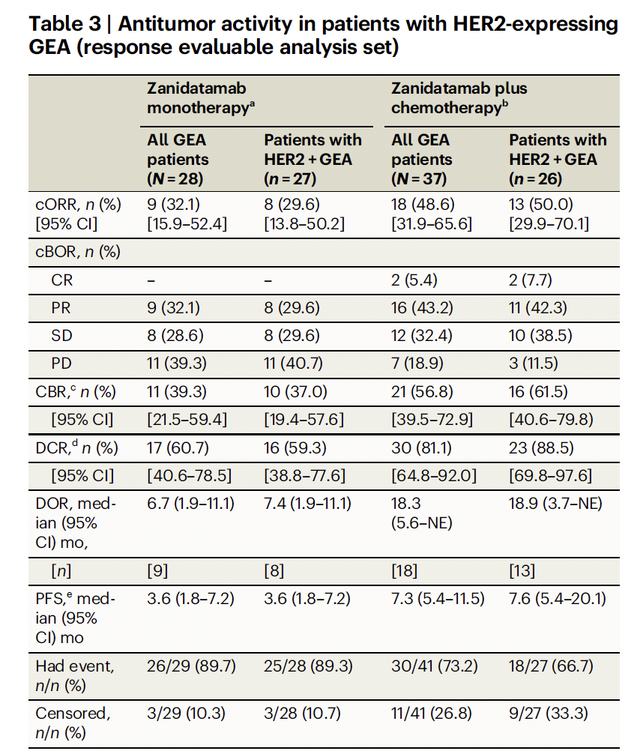
Nat Communication 2025

Slide 29
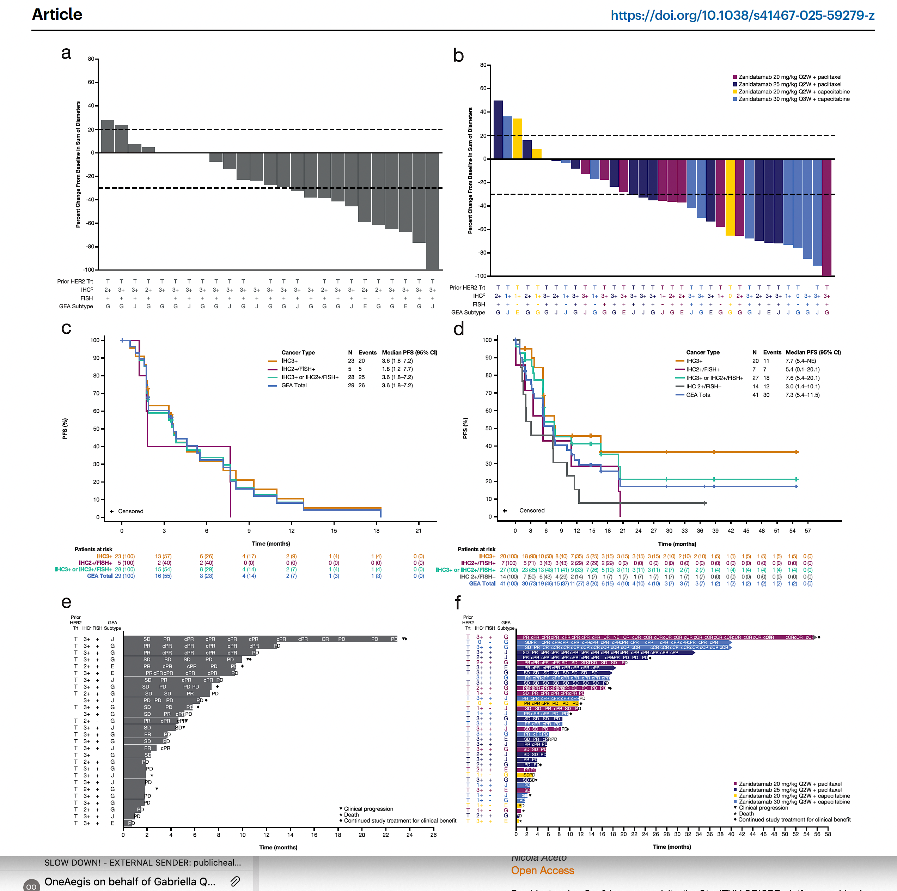
Nat Communication 2025

Slide 30
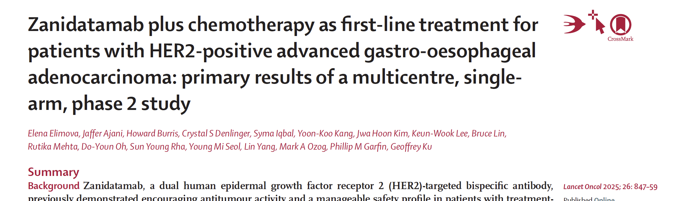

Slide 31
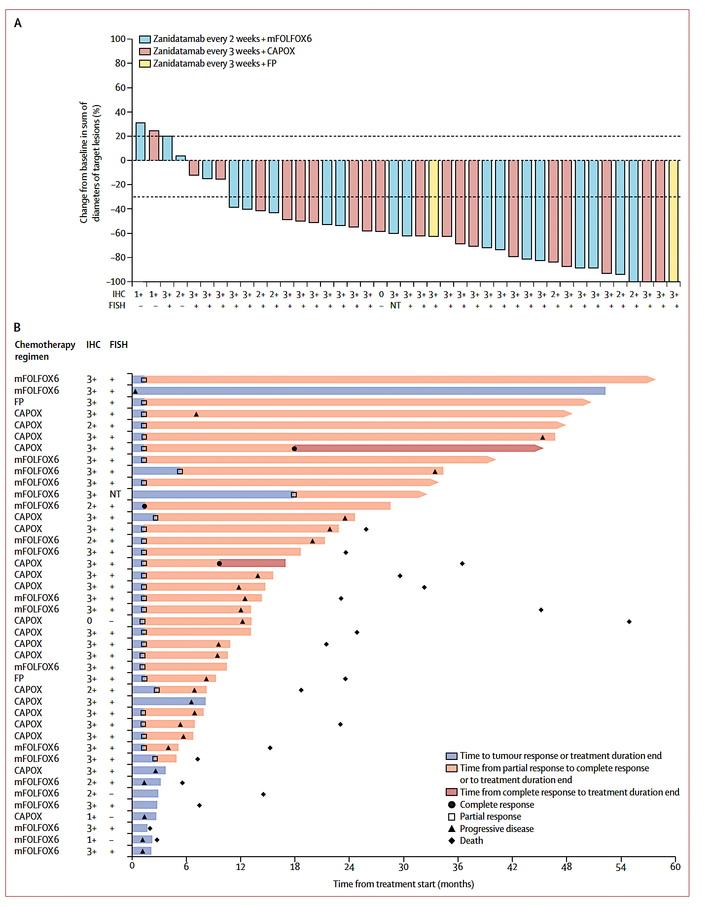
Lancet Oncology 2025

Slide 32
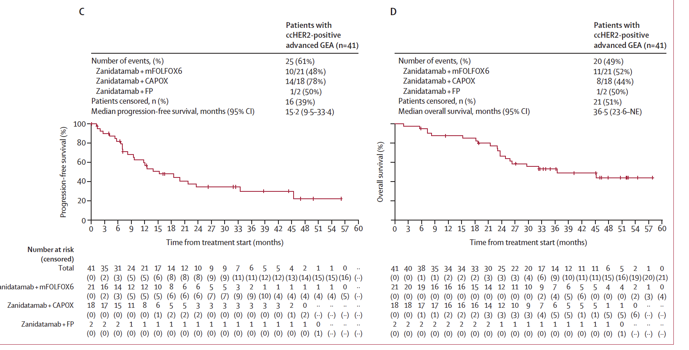
Lancet Oncology 2025
Zanidatamab + mFOLFOX6

Slide 33

HERIZON-GEA-01 Study Design
Global phase 3 trial of zanidatamab + chemotherapy ± tislelizumab vs trastuzumab + chemotherapy in previously untreated patients with HER2+ mGEA
Key Eligibility Criteria
Age ≥18 years
Unresectable, locally advanced, recurrent or metastatic GEA
HER2 IHC 3+ or IHC 2+/ISH+
per central testing
ECOG PS 0 or 1
No prior treatment for locally advanced or metastatic disease
No prior HER2-targeted agents or immunotherapy in any setting
Arm A: Trastuzumab +
chemotherapyª
Dual Primary Endpoints
PFS (per BICR)
OS
Select Secondary Endpoints
cORR (per BICR)
Frequency and severity of AEs
R 1:1:1
Arm B: Zanidatamab
1800 mg (<70 kg)/2400 mg (≥70 kg) IV Q3W
+ chemotherapyª
CT/MRI^{c} Q6W
Arm C: Zanidatamab
1800 mg (<70 kg)/2400 mg (≥70 kg) IV Q3W
+ tislelizumab^{b} + chemotherapyª
ClinicalTrials.gov: NCT05152147
Stratification Factors
Geographic region
HER2 status
ECOG PS
Prophylaxis to prevent IRR and diarrhea was
mandatory in the zanidatamab-containing arms
Treatment until disease progression/death/unacceptable toxicity
Chemotherapy could be discontinued after 6 cycles
ªPhysician’s choice of capecitabine plus oxaliplatin or 5-fluorouracil plus cisplatin. Chemotherapy was administered for at least 6 cycles or until disease progression, unacceptable toxicity, or another criterion for treatment discontinuation was met.
^{b}Tislelizumab 200 mg was administered IV Q3W. ^{c}CT/MRI scans were performed every 6 weeks for the first 54 weeks, then every 9 weeks.
AE, adverse event; BICR, blinded independent central review; cORR, confirmed objective response rate; CT, computed tomography; ECOG PS, Eastern Cooperative Oncology Group performance status; GEA, gastroesophageal adenocarcinoma;
HER2, human epidermal growth factor receptor 2; IHC, immunohistochemistry; IRR, infusion-related reaction; ISH, in situ hybridization; IV, intravenously; mGEA, advanced or metastatic GEA; MRI, magnetic resonance imaging; OS, overall survival;
PFS, progression-free survival; Q3W, every 3 weeks; Q6W, every 6 weeks; R, randomization.
Elena Elimova, MD

Slide 34
Statistical Design
Dual primary endpoints (PFS and OS): Analyzed in the intent-to-treat population using
log-rank tests with a 2-sided α = 0.05
  Primary PFS analysis: After target event count was reached and patients had ≥7 months of follow-up
  First interim OS analysis: Performed at the time of data cutoff for the primary PFS analysis
Fixed-Sequence Testing Procedure
PFSª
PFSª
OS^{b}
OS^{b}
OS
Zani + TIS + CT vs Tras + CT
Zani + CT vs Tras + CT
Zani + TIS + CT vs Tras + CT
Zani + CT vs Tras + CT
Zani + TIS + CT vs Zani + CT
ªFor the primary analysis of PFS, the 2-sided alpha was 0,05. ^{b}For the first interim analysis of OS, the 2-sided alpha was 0.020.
CT, chemotherapy; OS, overall survival; PFS, progression-free survival; TIS, tislelizumab; Tras, trastuzumab; Zani, zanidatamab.
Elena Elimova, MD

Slide 35
Patient Disposition
A total of 914 patients were randomized, and median follow-up was >2 years
Randomized
N = 914
Zanidatamab + CT
n = 304; 300 patients treatedª
Zanidatamab + tislelizumab + CT
n = 302; 299 patients treatedª
Trastuzumab + CT
n = 308; 302 patients treated
Ongoing treatment, n = 69 (23%)
Discontinued treatment, n = 231 (76%)
Progressive disease, n = 132
Adverse event, n = 25
Death, n = 27
Withdrawal by patient, n = 23
Physician decision, n = 19
Other, n = 5^{b}
Survival follow-up, n = 69 (23%)
Ongoing treatment, n = 88 (29%)
Discontinued treatment, n = 211 (70%)
Progressive disease, n = 117
Adverse event, n = 27
Death, n = 26
Withdrawal by patient, n = 26
Physician decision, n = 13
Other, n = 2^{b}
Survival follow-up, n = 58 (19%)
Ongoing treatment, n = 37 (12%)
Discontinued treatment, n = 265 (86%)
Progressive disease, n = 200
Adverse event, n = 10
Death, n = 17
Withdrawal by patient, n = 20
Physician decision, n = 13
Other, n = 5^{b}
Survival follow-up, n = 81 (26%)
Median (range) follow-up
26.0 (7.6–46.0) months
Median (range) follow-up
25.9 (7.9–45.5) months
Median (range) follow-up
25.8 (7.5–45.6) months
ªTreated includes all randomized patients who received any amount of any study treatment and does not necessarily reflect the safety analysis set. Five patients assigned to the zanidatamab-tislelizumab-chemotherapy arm did not receive tislelizumab and are included in the safety analysis set for the zanidatamab-chemotherapy arm. ^{b}Includes protocol violations and “other” reasons.
CT, chemotherapy.
Elena Elimova, MD

Slide 36
Baseline Demographics and Disease Characteristics
Demographics and clinical characteristics were balanced across all 3 treatment arms
 | Zanidatamab + CT (n = 304) | Zanidatamab + tislelizumab + CT (n = 302) | Trastuzumab + CT (n = 308)
Age, median (range), years | 62.5 (25–87) | 63.0 (22–81) | 64.0 (21–84)
Male sex | 244 (80.3) | 244 (80.8) | 238 (77.3)
Geographic region
Asia | 163 (53.6) | 159 (52.6) | 165 (53.6)
EU/North America | 91 (29.9) | 95 (31.5) | 93 (30.2)
Rest of the world | 50 (16.4) | 48 (15.9) | 50 (16.2)
ECOG PSª
0 | 134 (44.1) | 121 (40.1) | 120 (39.0)
1 | 170 (55.9) | 180 (59.6) | 188 (61.0)
Disease status
Metastatic | 295 (97.0) | 284 (94.0) | 299 (97.1)
Unresectable locally advanced | 9 (3.0) | 18 (6.0) | 9 (2.9)
 | Zanidatamab + CT (n = 304) | Zanidatamab + tislelizumab + CT (n = 302) | Trastuzumab + CT (n = 308)
Anatomical subtype
Gastric | 204 (67.1) | 208 (68.9) | 226 (73.4)
GEJ | 61 (20.1) | 74 (24.5) | 60 (19.5)
Esophageal | 39 (12.8) | 20 (6.6) | 22 (7.1)
HER2 IHC 3+ | 251 (82.6) | 251 (83.1) | 255 (82.8)
PD-L1 status^{b}
TAP score <1% | 108 (35.5) | 90 (29.8) | 98 (31.8)
TAP score ≥1% | 178 (58.6) | 187 (61.9) | 188 (61.0)
Choice of chemotherapy backbone
CAPOX | 276 (90.8) | 273 (90.4) | 282 (91.6)
FP | 28 (9.2) | 29 (9.6) | 26 (8.4)
All data are shown as n (%) unless otherwise indicated.
ªOne patient in the zanidatamab-tislelizumab-chemotherapy arm had an ECOG PS score of 2 at baseline. ^{b}PD-L1 status was missing for 7.1% (n = 65) of patients across arms.
CAPOX, capecitabine and oxaliplatin; CT, chemotherapy; ECOG PS, Eastern Cooperative Oncology Group performance status; EU, European Union; FP, 5-fluorouracil (5-FU) plus cisplatin; GEJ, gastroesophageal junction; HER2, human epidermal growth factor receptor 2; IHC, immunohistochemistry; PD-L1, programmed death-ligand 1; TAP, tumor area positivity.
Elena Elimova, MD

Slide 37
Primary Endpoint: PFS per BICR
Statistically significant and clinically meaningful improvement in PFS with zanidatamab + CT vs trastuzumab + CT (>4-month prolongation in median PFS)
100
Zanidatamab + CT | Trastuzumab + CT
12.4 (9.8–14.5) | 8.1 (7.0–8.9)
0.65 (0.52–0.81) P <0.0001
Zanidatamab + CT
Median PFS (95% CI), mo
HR (95% CI)
75
59.4%
(95% CI: 53.1–65.2)
Trastuzumab + CT
50
Progression-free survival (%)
38.0%
(95% CI: 31.5–44.4)
43.7%
(95% CI: 37.5–49.7)
31.5%
(95% CI: 24.9–38.3)
25
20.9%
(95% CI: 15.3–27.2)
15.6%
(95% CI: 10.1–22.1)
0
Censored
0
3
6
9
12
15
18
21
24
27
30
33
36
39
42
45
Months from randomization
Patients at risk
Zani + CT | 304 | 231 | 175 | 137 | 105 | 70 | 53 | 37 | 34 | 26 | 14 | 12 | 8 | 1 | 0
Tras + CT | 308 | 247 | 168 | 97 | 63 | 37 | 23 | 16 | 13 | 10 | 6 | 4 | 3 | 2 | 0
BICR, blinded independent central review; CT, chemotherapy; HR, hazard ratio; PFS, progression-free survival; Tras, trastuzumab; Zani, zanidatamab.
Elena Elimova, MD

Slide 38
Primary Endpoint: PFS per BICR
Statistically significant and clinically meaningful improvement in PFS with zanidatamab + tislelizumab + CT vs trastuzumab + CT (>4-month prolongation in median PFS)
100
Zanidatamab + tislelizumab + CT | Trastuzumab + CT
12.4 (9.8–18.5) | 8.1 (7.0–8.9)
0.63 (0.51–0.78) P <0.0001
Zanidatamab + tislelizumab + CT
Median PFS (95% CI), mo
HR (95% CI)
75
59.7%
(95% CI: 53.6–65.4)
Trastuzumab + CT
43.9%
(95% CI: 37.4–50.1)
50
Progression-free survival (%)
38.2%
(95% CI: 31.4–45.0)
43.7%
(95% CI: 37.5–49.7)
25
20.9%
(95% CI: 15.3–27.2)
15.6%
(95% CI: 10.1–22.1)
0
Censored
0
3
6
9
12
15
18
21
24
27
30
33
36
39
42
45
Months from randomization
Patients at risk
Zani + TIS + CT | 302 | 240 | 183 | 147 | 113 | 90 | 65 | 46 | 42 | 30 | 27 | 20 | 13 | 6 | 2 | 0
Tras + CT | 308 | 247 | 168 | 97 | 63 | 37 | 23 | 16 | 13 | 10 | 6 | 4 | 3 | 2 | 0
BICR, blinded independent central review; CT, chemotherapy; HR, hazard ratio; PFS, progression-free survival; Tras, trastuzumab; Zani, zanidatamab.
Elena Elimova, MD

Slide 39
PFS in Key Prespecified Subgroups
Events/patients
Zani + CT
vs Tras + CT
Zani + TIS + CT
vs Tras + CT
Subgroup | Category | Zanidatamab + CT | Zanidatamab + tislelizumab + CT | Trastuzumab + CT |  |  | PFS HRª (95% CI) |  |  | PFS HRª (95% CI)
All patients |  | 160/304 | 154/302 | 196/308 |  |  | 0.65 (0.52–0.81) |  |  | 0.63 (0.51–0.78)
Age, years | <65 | 94/174 | 79/163 | 105/162 |  |  | 0.63 (0.47–0.83) |  |  | 0.55 (0.41–0.74)
 | ≥65 | 66/130 | 75/139 | 91/146 |  |  | 0.72 (0.53–1.00) |  |  | 0.71 (0.52–0.96)
Geographic region | Asia | 81/163 | 78/159 | 106/165 |  |  | 0.64 (0.48–0.86) |  |  | 0.56 (0.42–0.75)
 | EU/NA | 49/91 | 47/95 | 55/93 |  |  | 0.73 (0.49–1.08) |  |  | 0.65 (0.44–0.97)
 | ROW | 30/50 | 29/48 | 35/50 |  |  | 0.63 (0.39–1.04) |  |  | 0.74 (0.45–1.23)
ECOG PS | 0 | 63/134 | 51/121 | 74/120 |  |  | 0.63 (0.45–0.89) |  |  | 0.51 (0.35–0.73)
 | 1 | 97/170 | 103/180 | 122/188 |  |  | 0.70 (0.53–0.91) |  |  | 0.69 (0.53–0.90)
Anatomical subtype | Gastric | 112/204 | 105/208 | 140/226 |  |  | 0.74 (0.57–0.95) |  |  | 0.61 (0.47–0.79)
 | GEJ | 29/61 | 43/74 | 44/60 |  |  | 0.52 (0.32–0.83) |  |  | 0.70 (0.46–1.08)
 | Esophageal | 19/39 | 6/20 | 12/22 |  |  | 0.60 (0.29–1.25) |  |  | 0.32 (0.12–0.85)
HER2 status | IHC 3+ | 125/251 | 121/251 | 167/255 |  |  | 0.55 (0.43–0.69) |  |  | 0.54 (0.43–0.69)
 | IHC 2+/ISH+ | 35/51 | 33/51 | 29/52 |  |  | 1.73 (1.06–2.83) |  |  | 1.08 (0.65–1.78)
PD-L1 status | TAP <1% | 61/108 | 47/90 | 71/98 |  |  | 0.62 (0.44–0.87) |  |  | 0.47 (0.32–0.69)
 | TAP ≥1% | 94/178 | 91/187 | 114/188 |  |  | 0.74 (0.56–0.98) |  |  | 0.65 (0.49–0.86)
ªThe widths of the confidence intervals were not adjusted for multiplicity and cannot be used to infer treatment effects.
CT, chemotherapy; ECOG PS, Eastern Cooperative Oncology Group performance status; EU, European Union;
GEJ, gastroesophageal junction; HER2, human epidermal growth factor receptor 2; HR, hazard ratio; IHC, immunohistochemistry; ISH, in situ hybridization; NA, North America; PD-L1, programmed death-ligand 1; PFS, progression-free survival;
ROW, rest of world; TAP, tumor area positivity; TIS, tislelizumab; Tras, trastuzumab; Zani, zanidatamab.
Favors Zani + CT
Favors Tras + CT
Favors Zani + TIS + CT
Favors Tras + CT
Elena Elimova, MD

Slide 40
Primary Endpoint: Overall Survival
At this interim analysis, there was a strong trend toward significance for OS favoring zanidatamab + CT vs trastuzumab + CT (5-month improvement in median OS)
100
Zanidatamab + CT | Trastuzumab + CT
24.4 (20.4–30.0) | 19.2 (16.8–21.8)
0.80 (0.64–1.01) P = 0.0564
Zanidatamab + CT
Median OS (95% CI), mo
HR (95% CI)
75
Trastuzumab + CT
50.3%
(95% CI: 43.6–56.6)
50
42.2%
(95% CI: 35.1–49.2)
Overall survival (%)
38.8%
(95% CI: 32.2–45.4)
25
30.0%
(95% CI: 23.4–36.8)
0
Censored
0
3
6
9
12
15
18
21
24
27
30
33
36
39
42
45
48
Months from randomization
Patients at risk
Zani + CT | 304 | 277 | 257 | 222 | 187 | 156 | 121 | 98 | 78 | 56 | 41 | 28 | 21 | 6 | 3 | 1 | 0
Tras + CT | 308 | 284 | 261 | 219 | 178 | 140 | 106 | 77 | 61 | 50 | 33 | 22 | 17 | 8 | 2 | 2 | 0
CT, chemotherapy; HR, hazard ratio; OS, overall survival; Tras, trastuzumab; Zani, zanidatamab.
Elena Elimova, MD

Slide 41
Primary Endpoint: Overall Survival
Zanidatamab + tislelizumab + CT demonstrated a statistically significant and clinically meaningful OS benefit with a >7-month improvement in median OS vs trastuzumab + CT
100
Zanidatamab + tislelizumab + CT | Trastuzumab + CT
26.4 (21.5–30.3) | 19.2 (16.8–21.8)
0.72 (0.57–0.90) P = 0.0043
Median OS (95% CI), mo
HR (95% CI)
Zanidatamab + tislelizumab + CT
75
Trastuzumab + CT
54.3%
(95% CI: 47.6–60.5)
50
43.8%
(95% CI: 36.5–50.9)
Overall survival (%)
38.8%
(95% CI: 32.2–45.4)
25
30.0%
(95% CI: 23.4–36.8)
0
Censored
0
3
6
9
12
15
18
21
24
27
30
33
36
39
42
45
48
Months from randomization
Patients at risk
Zani + TIS + CT | 302 | 267 | 246 | 222 | 190 | 157 | 125 | 96 | 82 | 64 | 49 | 36 | 27 | 10 | 4 | 2 | 0
Tras + CT | 308 | 284 | 261 | 219 | 178 | 140 | 106 | 77 | 61 | 50 | 33 | 22 | 17 | 8 | 2 | 2 | 0
CT, chemotherapy; HR, hazard ratio; OS, overall survival; TIS, tislelizumab; Tras, trastuzumab; Zani, zanidatamab.
Elena Elimova, MD

Slide 42
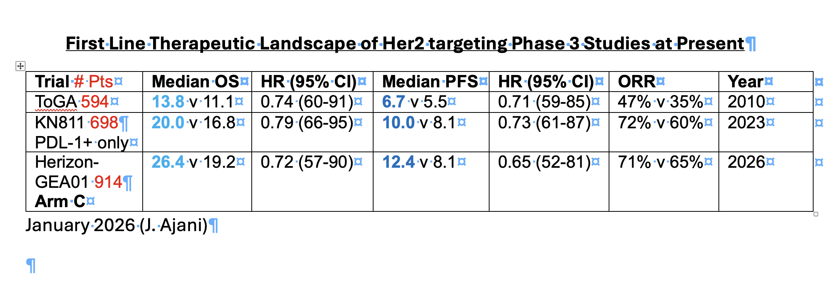

Slide 43
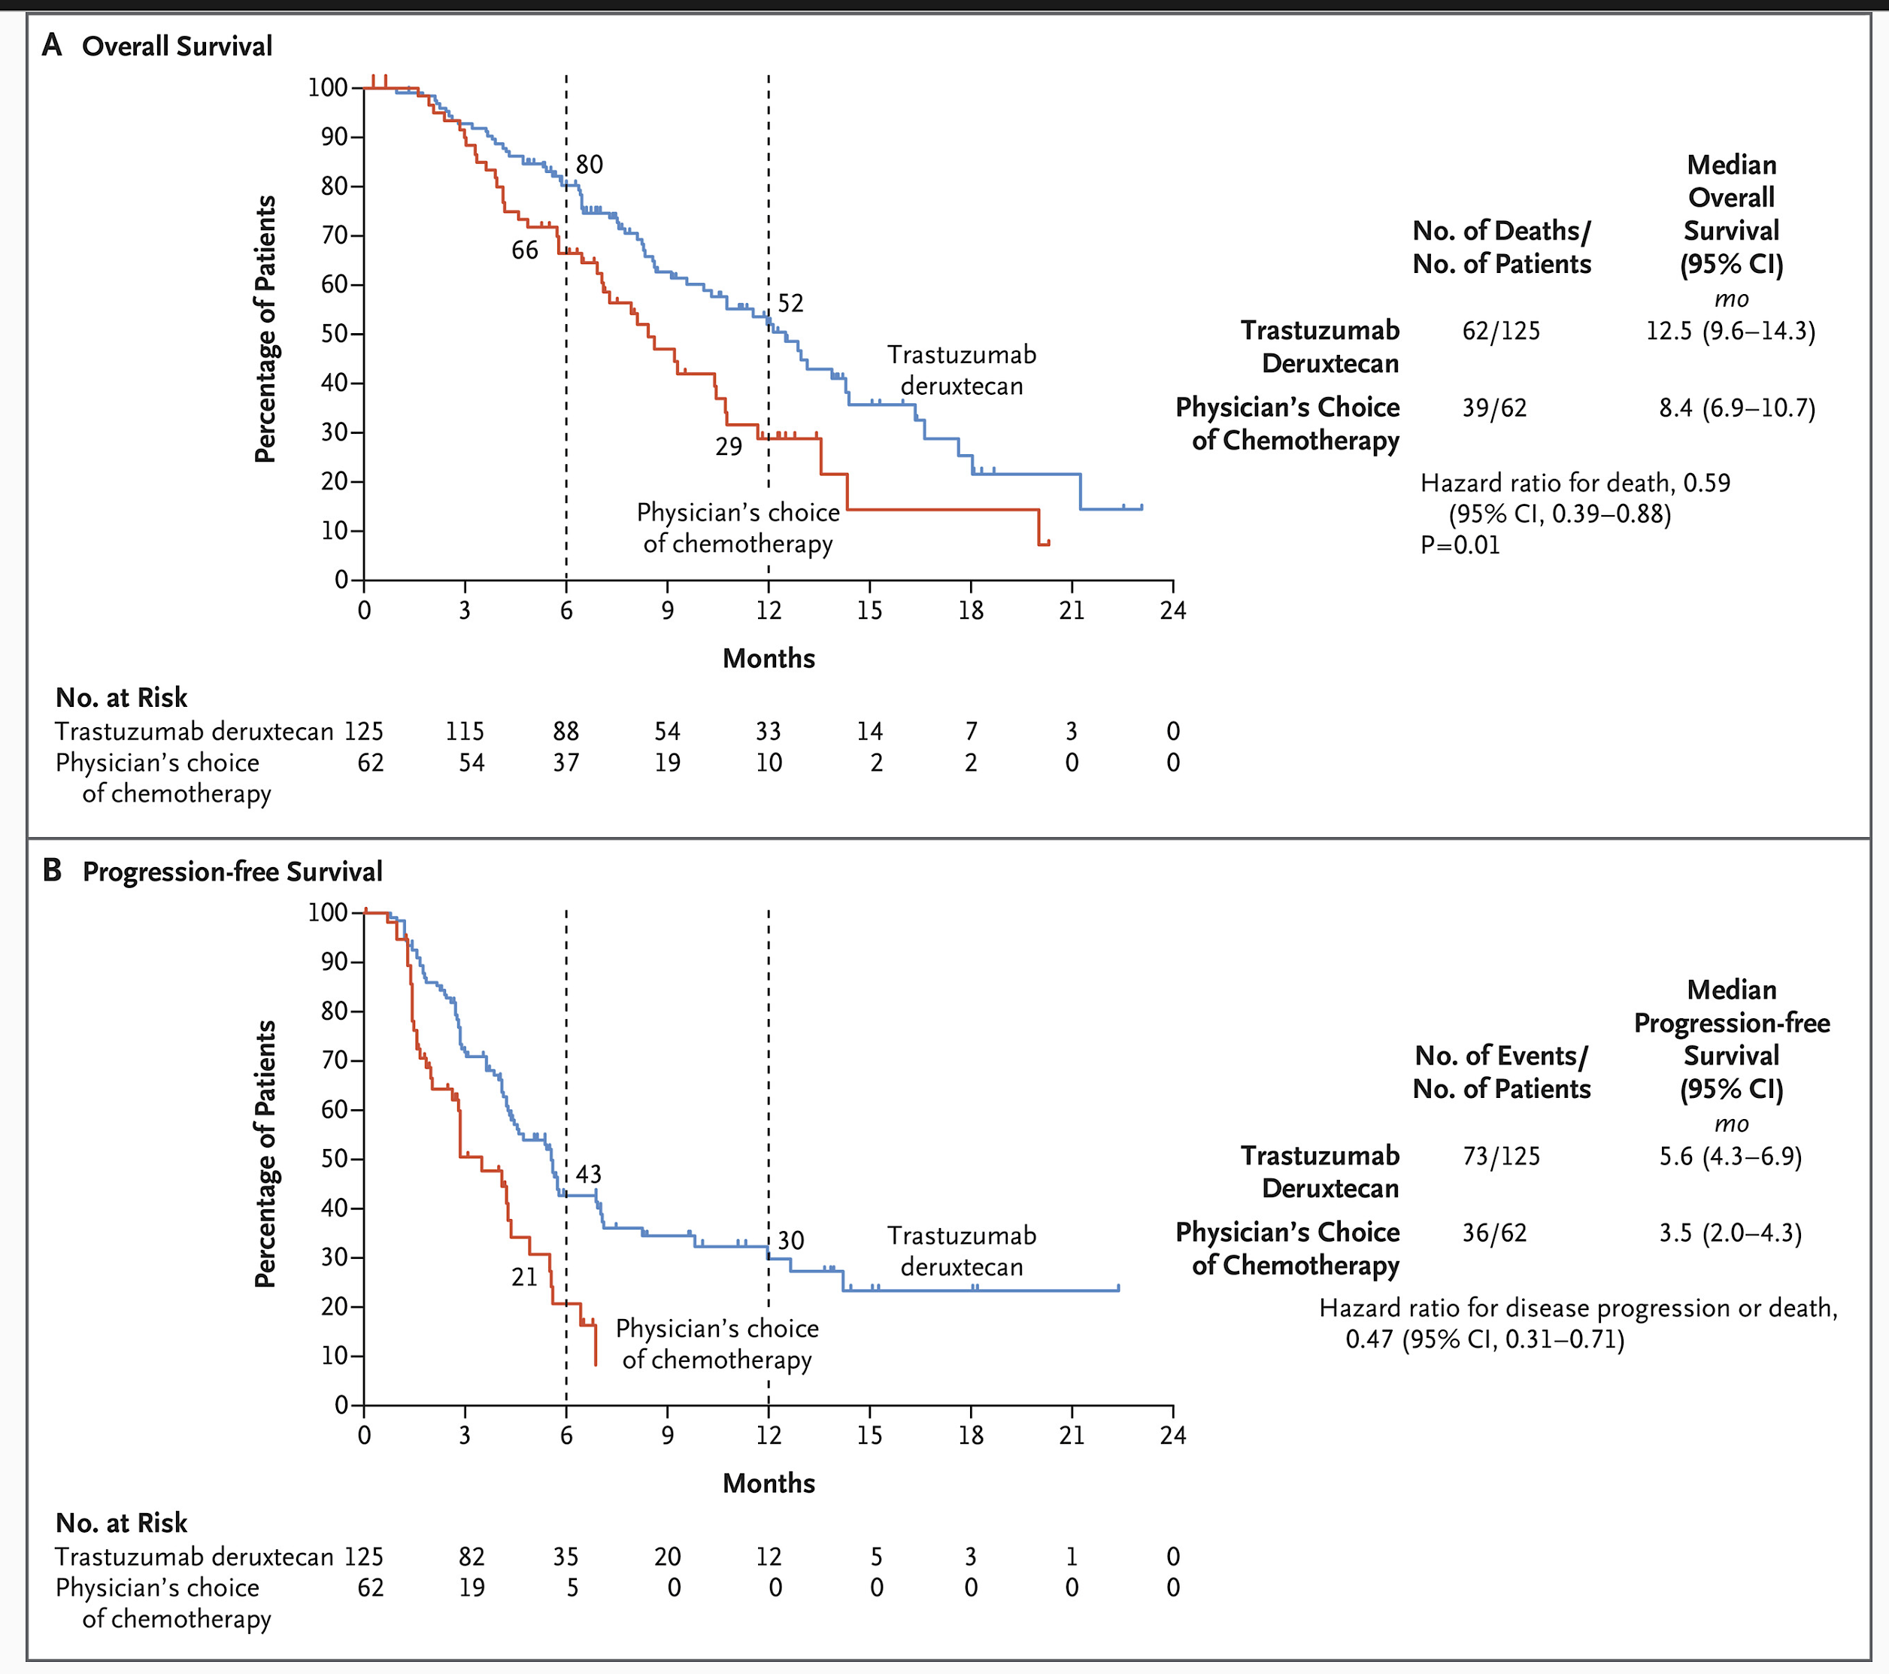
NEJM 2020:18:2419-2430
Destiny Gastric01

Slide 44
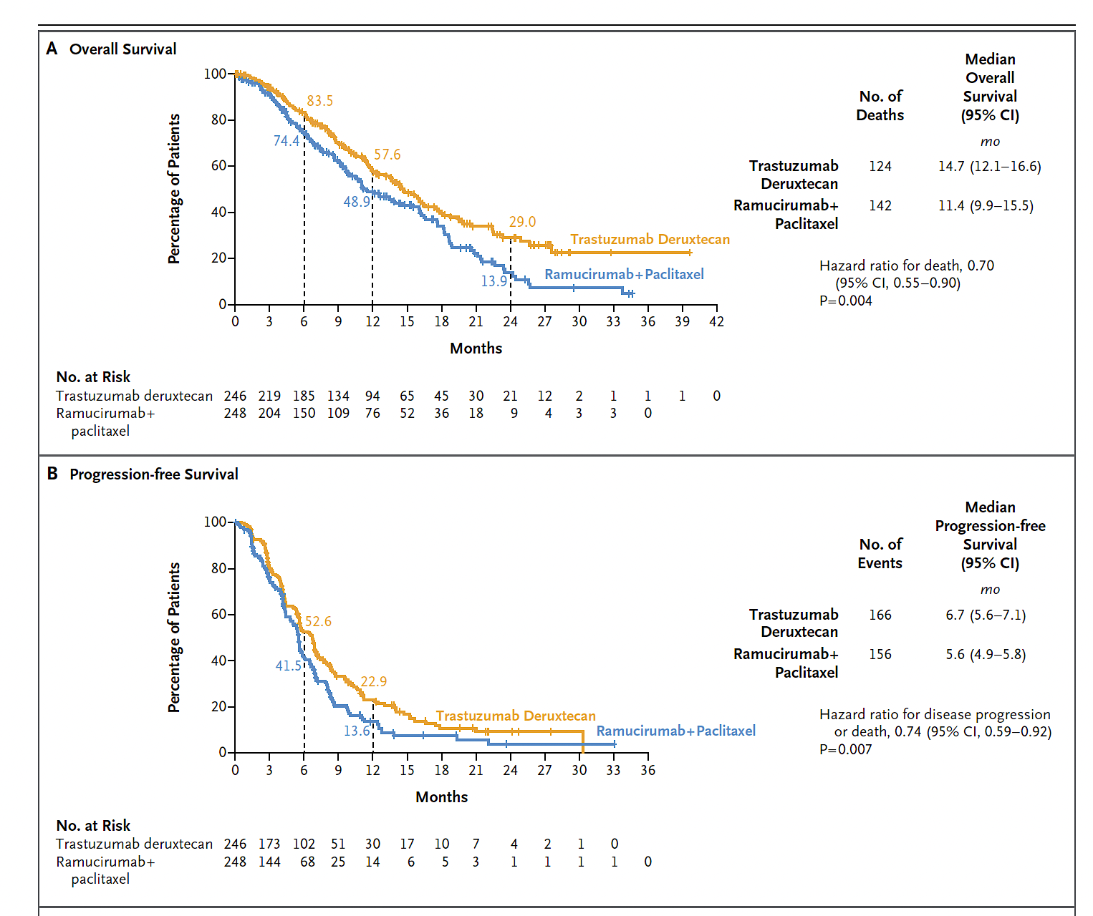
NEJM 2025:336-348. (Interim Analysis)
Destiny Gastric04
Total recruited
n= 494
ORR
44 vs 29
Analyzed here
n=248
Asians = 24%
EU = 53%
Her2 3+ = 84%
Her2 2+/+ = 15%
Median FU
16.8 mo

Slide 45
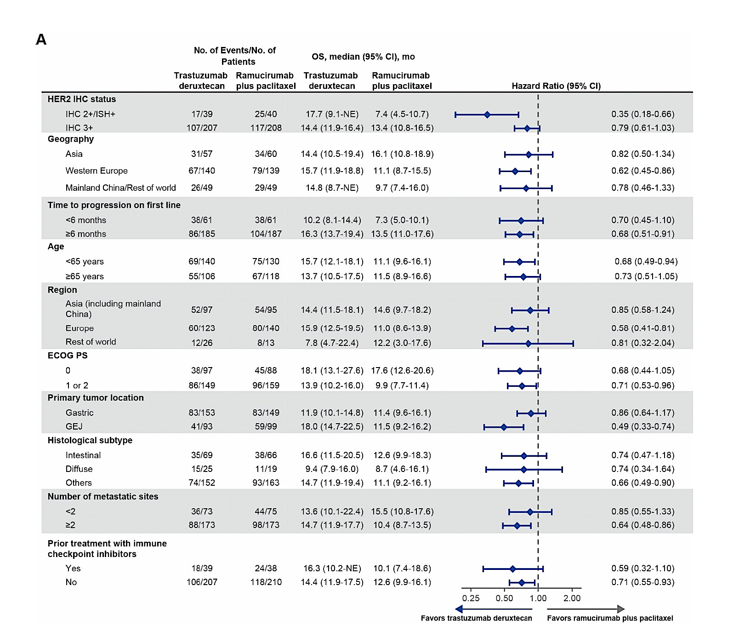
Destiny Gastric04-Less effective in Diffuse Type

Slide 46
Conclusions
Her2 space for gastric and gastroesophageal cancers is evolving rapidly
Zanidatamab is impressively superior to trastuzumab (should replace it)
Zani-induced toxicities are manageable
Tislelizumab improved PFS and OS in the HerizonGEA01 study establishing a new benchmark in first line (never been achieved before).
TDXd is solidly established in 2nd line
Looking forward to results of Destiny Gastric01, Artemide Gastric01, and HLX-Gastric-01 trials in first line.

Slide 47
Questions from General Medical Oncologists —
HER2-Targeted Approaches for Advanced GE Cancers
56 yr old with de novo metastatic gastric cancer, HER2-positive, CPS 2. Would you use zanidatamab in the front-line setting? What are your thoughts regarding tislelizumab? Any differentiating features from other IO agents? How does tislelizumab compare to pembro/nivo?
62 y/o female with Stage IV GEJ adenocarcinoma, PD-L1 CPS of 5, HER2 IHC 3+. Before being seen by us, pt was treated with FLOT x 3 cycles with stable disease. Pt prefers to be treated by our med onc service from this point on. Should I give pembro + trastuzumab + FLOT? Or is it better to proceed with pembro + trastuzumab + FOLFOX?

Slide 48
Questions from General Medical Oncologists —
HER2-Targeted Approaches for Advanced GE Cancers
80 y/o F with de novo HER2+ GEJ cancer with extensive liver mets presented w/ weight loss and FTT, ECOG PS 2 bordering on 3. What 1L rx would you offer this pt, if any (assuming she’s interested)?
87 yr old male treated with front-line 5-FU with pembro and trastuzumab now with progressive disease with borderline functional status. In an elderly patient such as this, how do we decide what may be the most effective option but also tolerable?

Slide 49
Questions from General Medical Oncologists —
HER2-Targeted Approaches for Advanced GE Cancers
52 y/o M with DM, HTN, active tobacco use (40 pack-years) and GEJ adenocarcinoma, HER2 3+, PD-L1 22%, with lymph node involvement only, including R supraclavicular, R hilar, R mediastinal and gastrohepatic LN regions on PET/CT. Patient wants to pursue surgery but plan is to start with neoadjuvant therapy. Would you offer this patient neoadjuvant therapy with FLOT + durva? Or would you consider this patient inoperable with metastatic disease and use FOLFOX + trastuzumab + IO? What about zanidatamab/chemotherapy +/- tislelizumab?

Slide 50
Questions from General Medical Oncologists —
HER2-Targeted Approaches for Advanced GE Cancers
73-year-old female with 6-month history of dysphagia found on endoscopy to have semi-obstructive GEJ adenocarcinoma, HER2+ by IHC and FISH, no nodal or distant spread on imaging. What neoadjuvant approach would you recommend?
65 y/o with locally advanced HER2+ GEJ cancer. Is there a role for HER2-targeted therapy in locally advanced HER2+ GEJ cancer?

Slide 51
Questions from General Medical Oncologists —
HER2-Targeted Approaches for Advanced GE Cancers
77-year-old male, taken for radical gastrectomy without preop oncology consult, found to have Stage IIIA disease but tumor HER2 overexpressed. Adjuvant therapy recommendations?
35 y/o M with dysphagia and weight loss with GEJ mass. EGD confirms HER2+ dz, PAC placed and diagnostic laparoscopy reveals no peritoneal dz but small peripheral liver lesion, also bx+ for HER2+ adenocarcinoma of GEJ origin. Quadruplet 1L systemic Rx, f/b restaging and resection of oligomet?

Slide 52
Agenda
Module 1: HER2-Targeted Approaches for Advanced Gastroesophageal Cancers — Dr Ajani
Module 2: Targeting Claudin 18.2 in Advanced Gastroesophageal Cancers —
Dr Strickler
Module 3: Optimal Incorporation of Immunotherapeutic Strategies into Treatment for Patients with Metastatic Gastroesophageal Tumors —
Dr Mehta
Module 4: Other Novel Agents and Strategies Under Evaluation for Advanced Gastroesophageal Cancers — Dr Klempner

Slide 53
TARGETING CLAUDIN 18.2 (CLDN18.2) IN ADVANCED GASTROESOPHAGEAL CANCERS
John Strickler, MD
Professor of Medicine
Associate Director, Clinical Research – GI
Co-Leader, Molecular Tumor Board
Duke University
Durham, North Carolina
Courtesy of David H. Ilson, MD PhD, FASCO, FACP

Slide 54
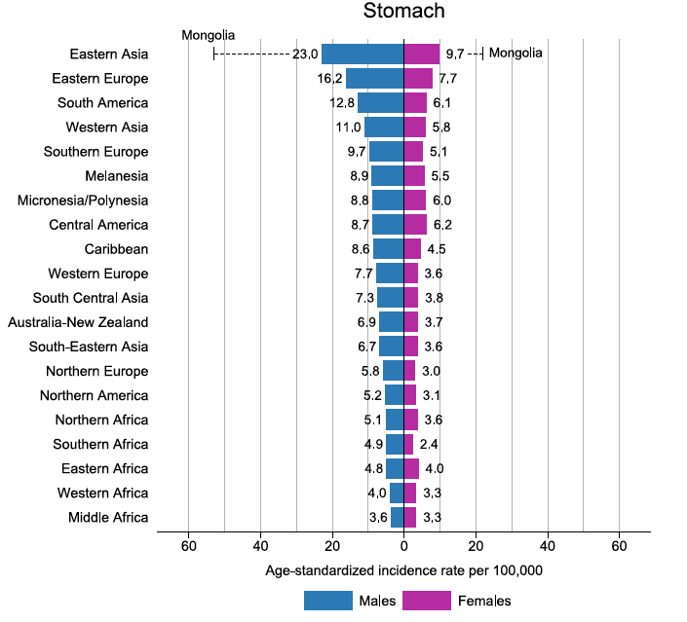

Gastric Cancer: Global Incidence: 2022
5th leading cause of cancer
5th leading cause of cancer related death
Uncommon in the U.S. and Europe
No effective screening or early detection
Bray et al CA J Clin 74: 229; 2024

Slide 55
Metastatic Disease: NCCN Endorsed Chemo
2 drug regimens
  FOLFOX, CAPE-OX or CIS, FOLFIRI
3 drug regimens + docetaxel (DCF, mDCF, FLOT) not recommended
  No survival benefit for FLOT over FLO, patients 65 or older: FLOT65
  No survival benefit for Doc + S-1/Cisplatin: JCOG 1013
  TFOX > FOLFOX in French FFCD / Prodige 51 Trial
  ARMANI: Early change to paclitaxel ramucirumab from FOLFOX
    Access to Ramucirumab second line limited in both studies
JNCCN 23: 169;2025 EJC 49: 835; 2013 Lancet Gastroenterol Hepatol 4: 501;2019 Lancet Onc 26: 732; 2025 Lancet Onc 25: 1539; 2024

Slide 56
Metastatic Disease: NCCN Endorsed Chemo
Add trastuzumab in HER2+, add pembro in CPS > = 1%
Add Nivo to chemo in CPS > = 1%
Add Pembro to chemo in CPS > = 1%
Add Tislelizumab to chemo in CPS > = 1%
Add Zolbetuximab if Claudin 18.2 positive at > = 75%
MSI High: First line use of CPI + / - chemo
JNCCN 23: 169; 2025

Slide 57
Minimum biomarker testing in a newly diagnosed M1 Esophagogastric Cancer
1) IHC for HER2
2) IHC for DNA mismatch repair protein deficiency
  Esophageal cancer: < 1%
  Gastric cancer: 7%
3) IHC for PDL-1, Combined positive score
4) IHC for Claudin 18.2
NGS
  Blood based genomic testing if tissue unavailable
  Covers gene amplification and Validates MSI
  Tests for rare but targetable genes
    NTRK gene fusion, BRAF V600E, RET gene fusion
  Assesses TMB

Slide 58
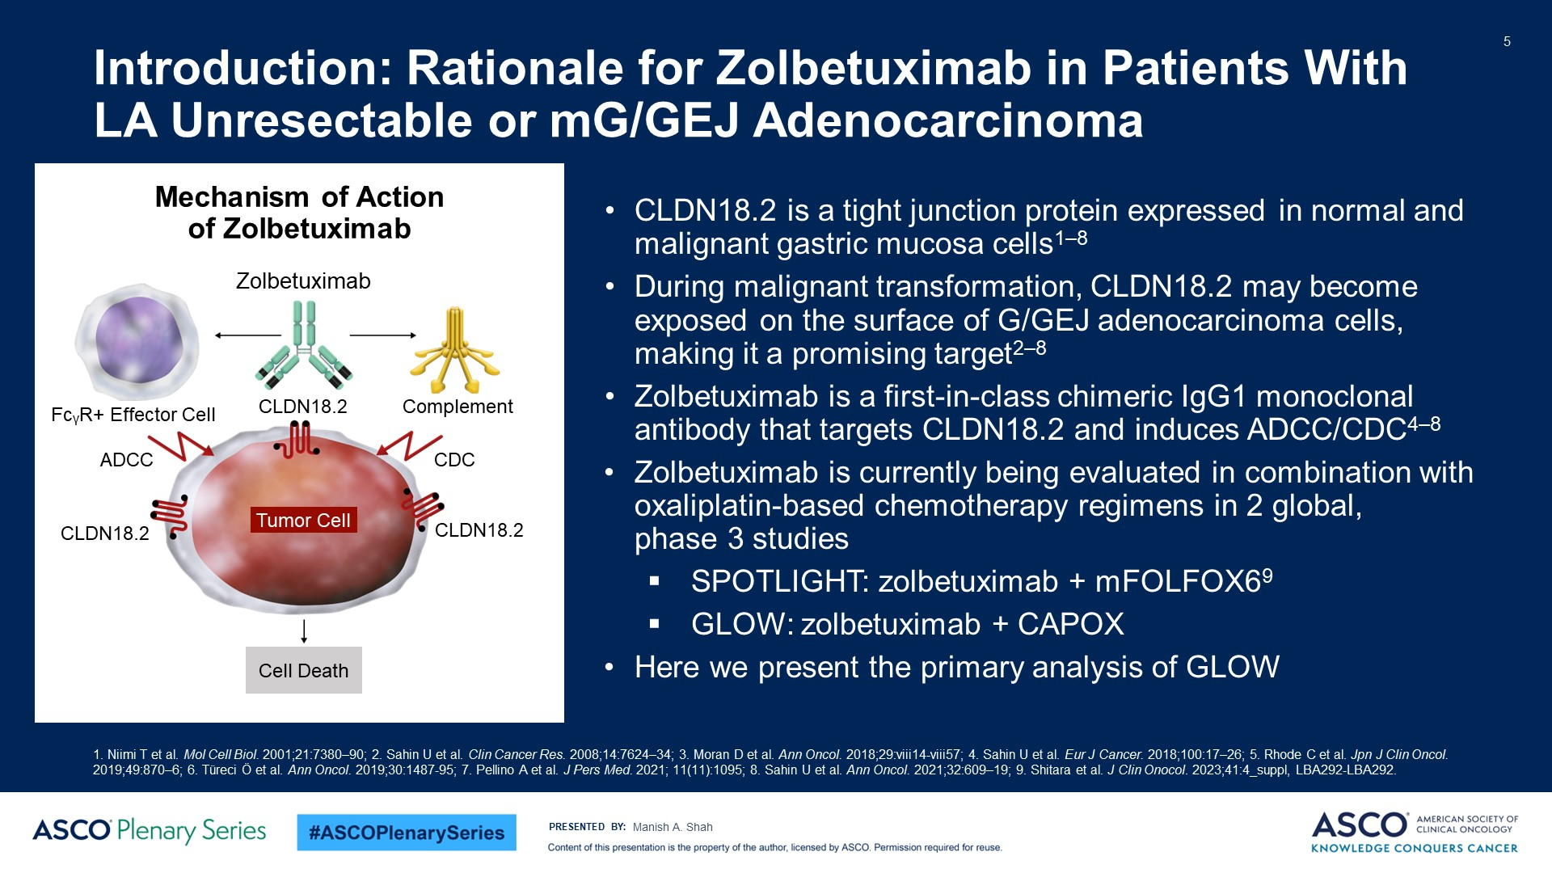
Introduction: Rationale for Zolbetuximab in Patients With LA Unresectable or mG/GEJ Adenocarcinoma
Content of this presentation is the property of the author, licensed by ASCO. Permission required for reuse.

Slide 59
Prevalence and Impact of CLDN18.2 Expression
Single Institution series from Japan, 408 patients 2015-2019
CLDN18.2 by IHC with Clone 43-14A Roche Ventana antibody, + > = 75%
CLDN18.2 expression similar across tumor subtypes
  24% were positive including MMR-D (20.8%), EBV + (26.7%), HER2 + (26.7%), and “all negative” (23.8%)
  CPS > = 5% 41.9% of CLDN18.2 +
  No change in CLDN18.2 expression before and after first line chemo
For first and second line chemo, CLDN18.2 had no effect on PFS or OS
For later line CPI therapy, CLDN18.2 had no effect on outcome
Kubota and Shitara ESMO Open 8: 1; 2023

Slide 60
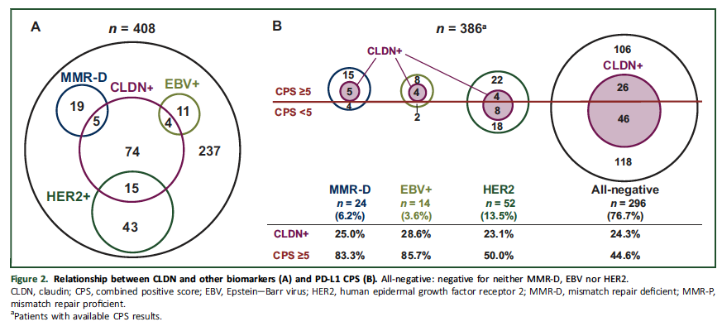
CLDN18.2 Expression Similar Across Tumor Subtypes
Kubota and Shitara ESMO Open 8: 1; 2023

Slide 61
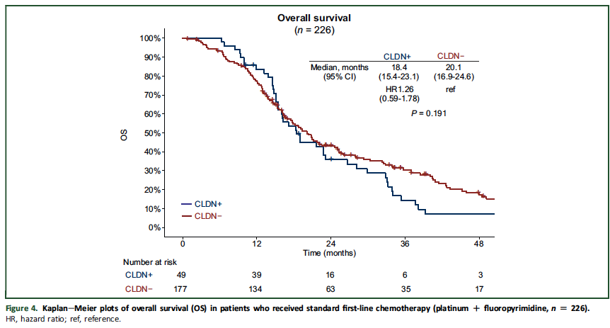
CLDN18.2 and OS with First Line Chemo
Kubota and Shitara ESMO Open 8: 1; 2023

Slide 62
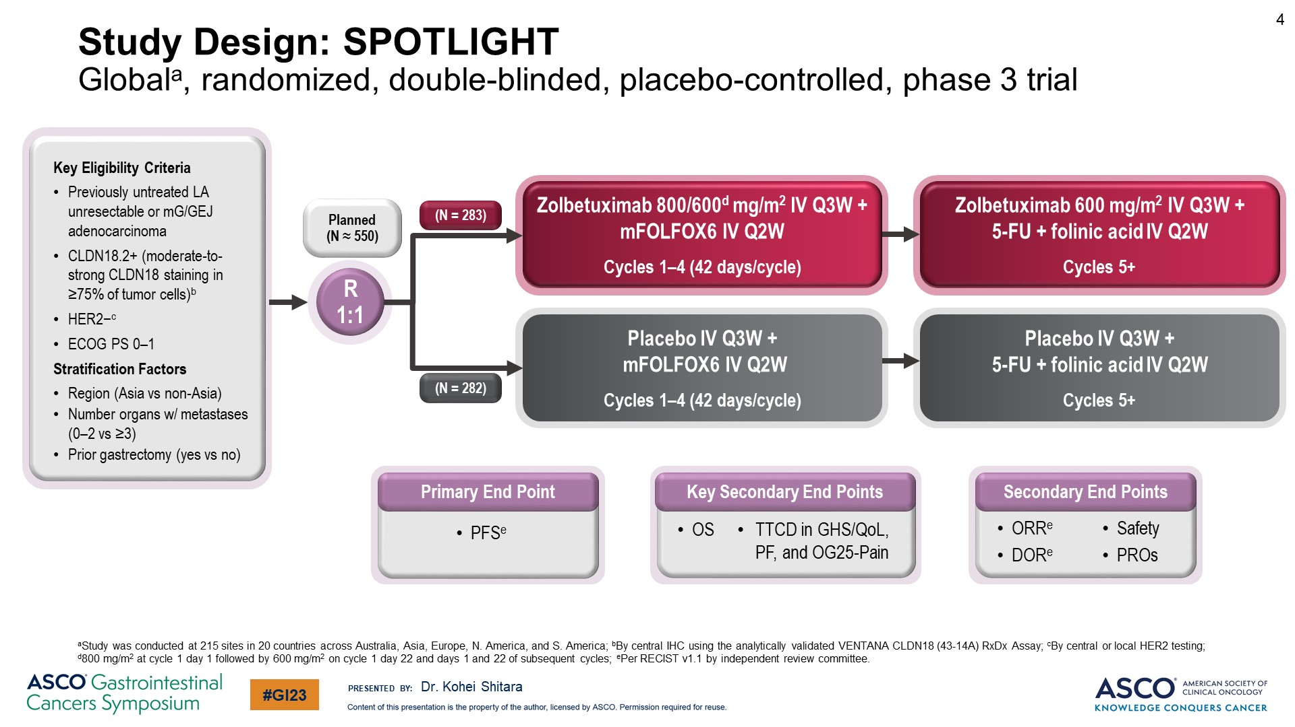
Slide 4
Shitara Lancet 401: 1655; 2023
Content of this presentation is the property of the author, licensed by ASCO. Permission required for reuse.

Slide 63
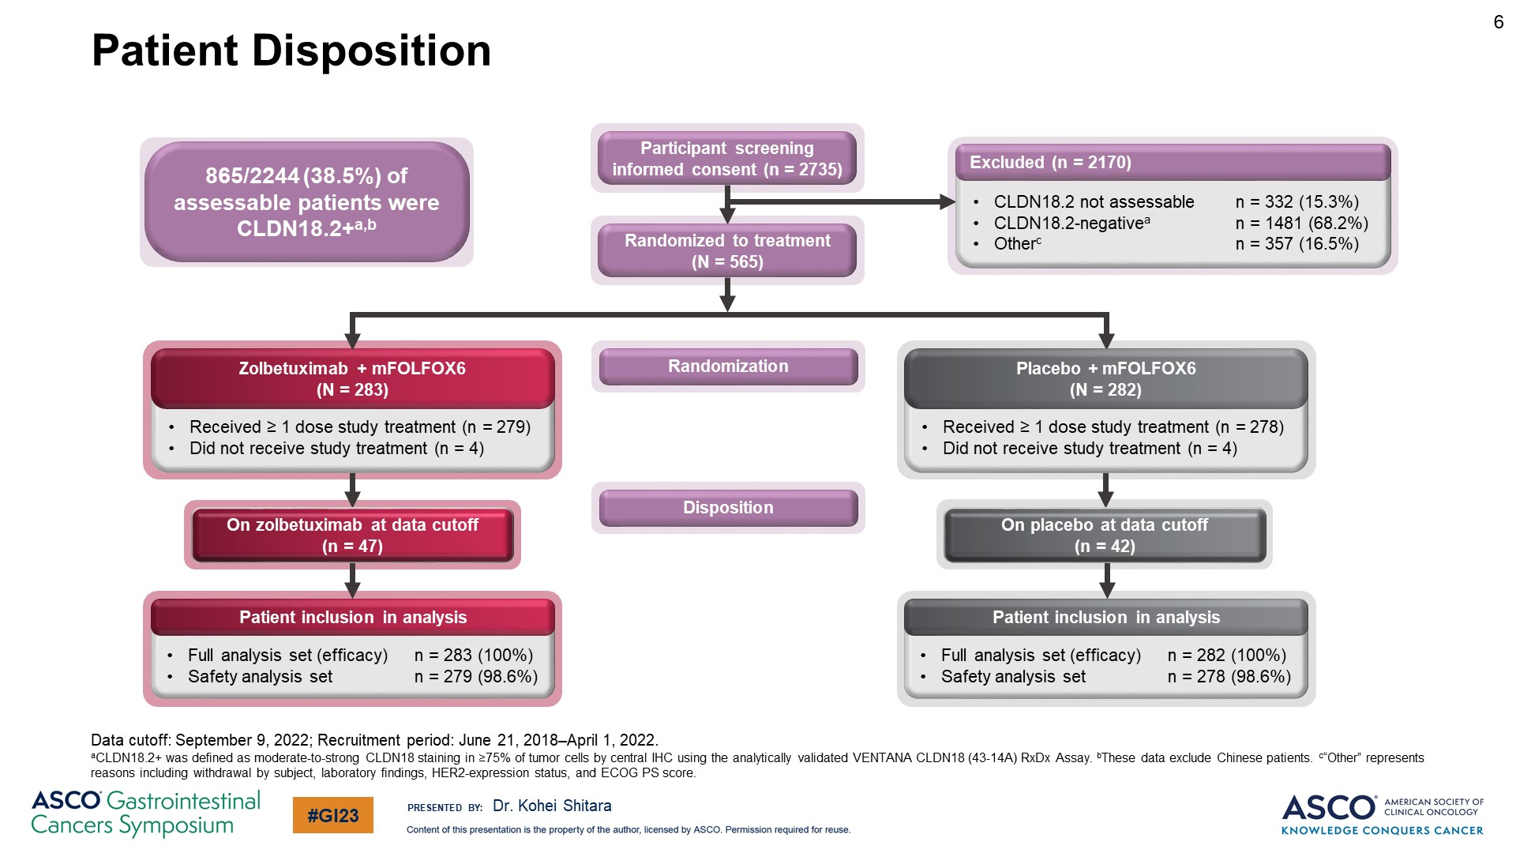
Slide 6
Content of this presentation is the property of the author, licensed by ASCO. Permission required for reuse.

Slide 64
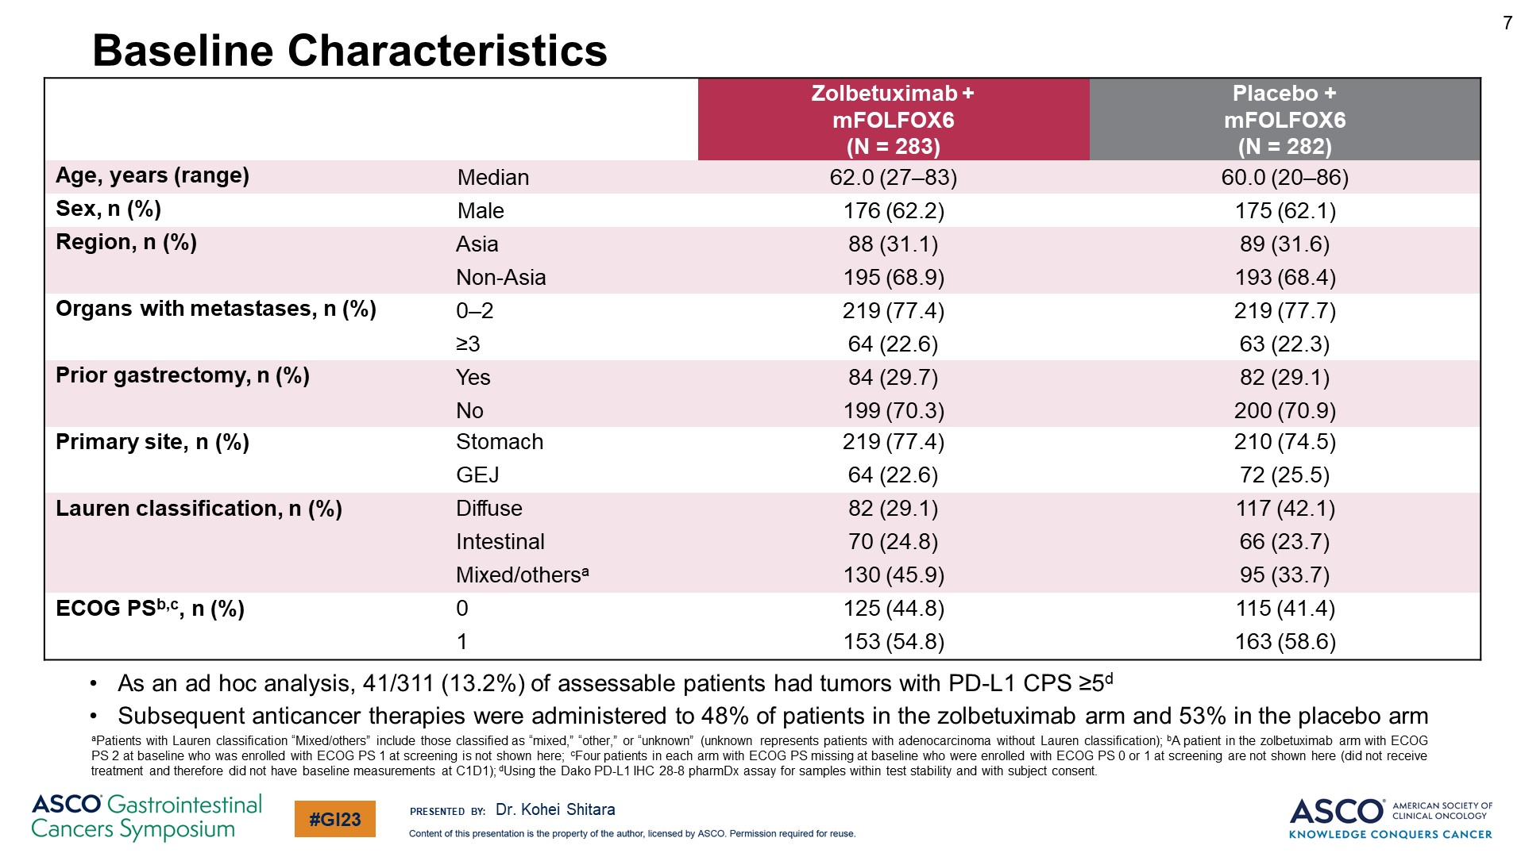
Baseline Characteristics
Content of this presentation is the property of the author, licensed by ASCO. Permission required for reuse.

Slide 65
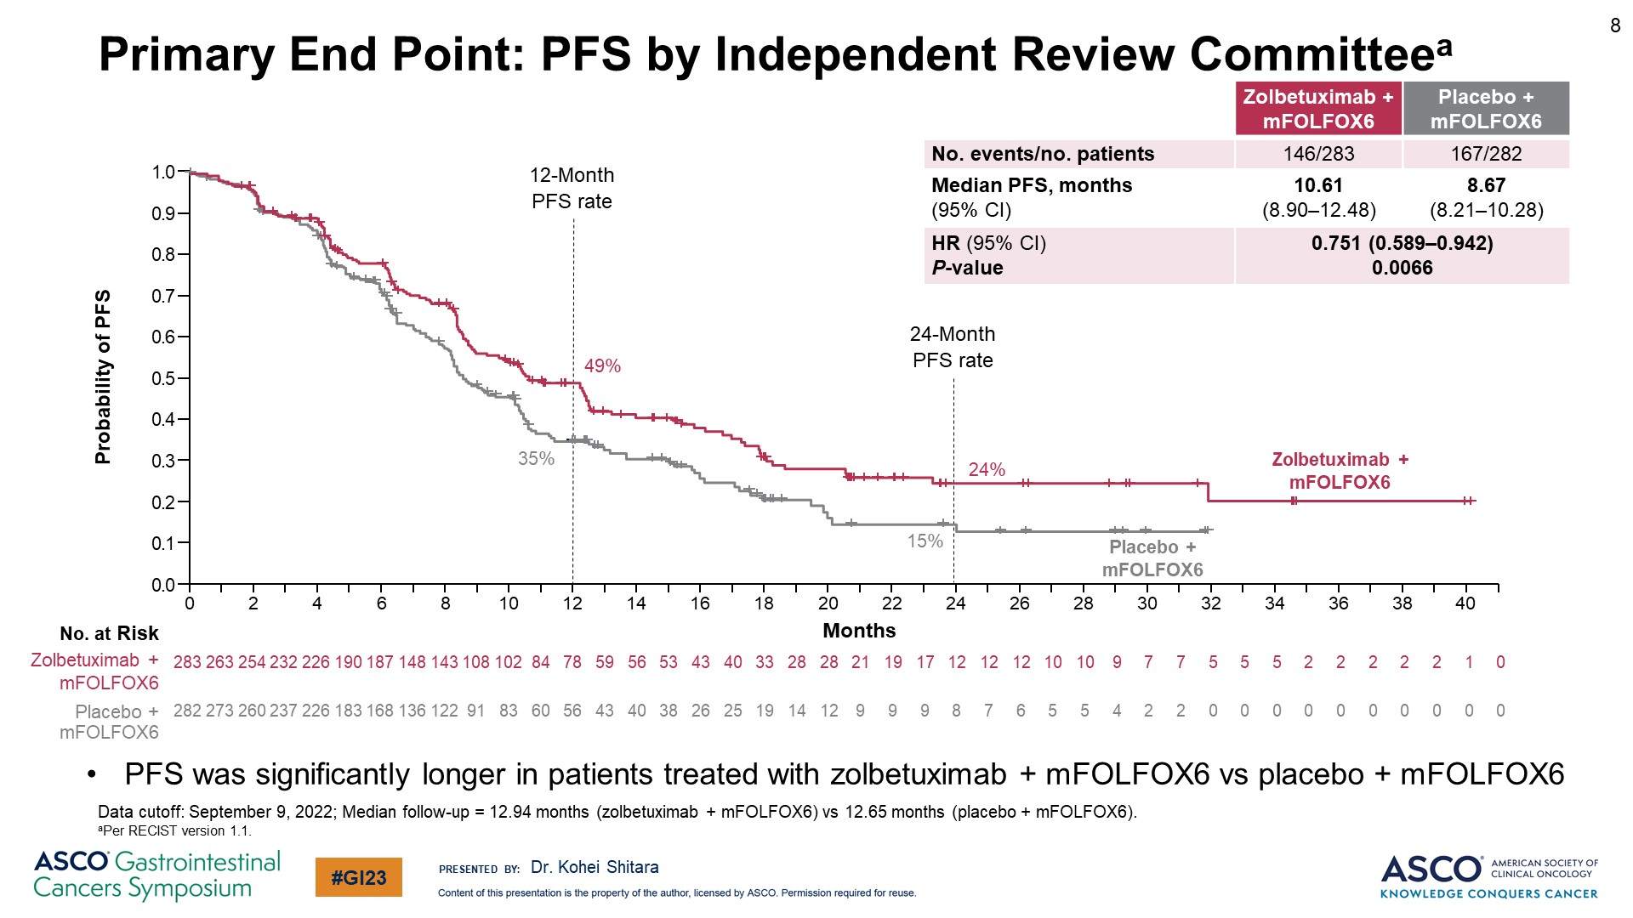
Primary End Point: PFS by Independent Review Committeea
Content of this presentation is the property of the author, licensed by ASCO. Permission required for reuse.

Slide 66
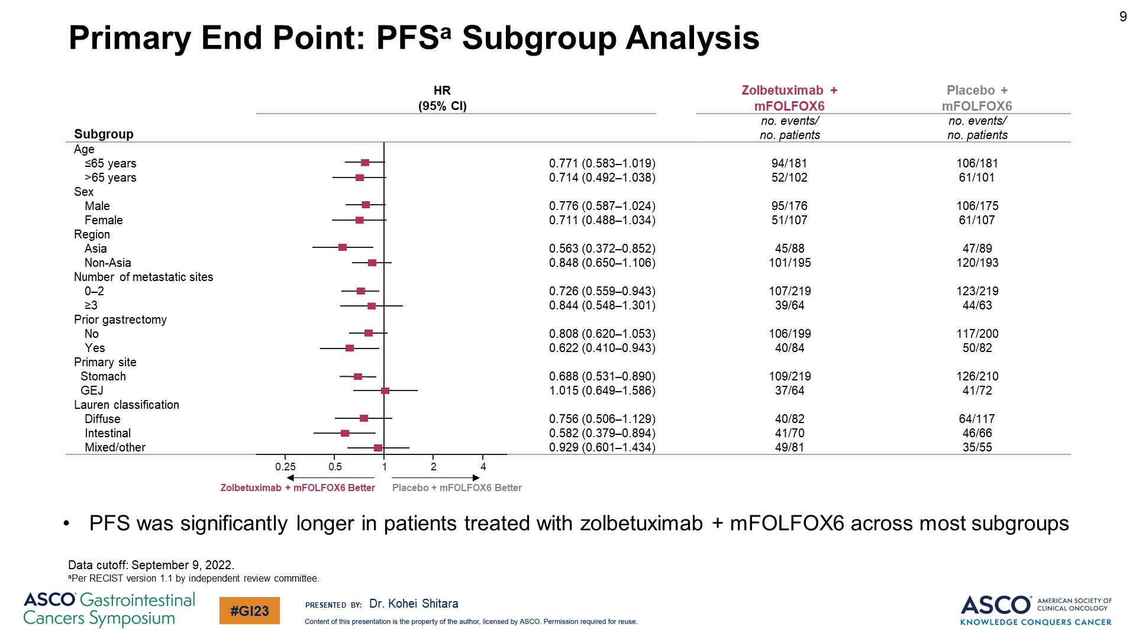
Primary End Point: PFSa Subgroup Analysis
Content of this presentation is the property of the author, licensed by ASCO. Permission required for reuse.

Slide 67
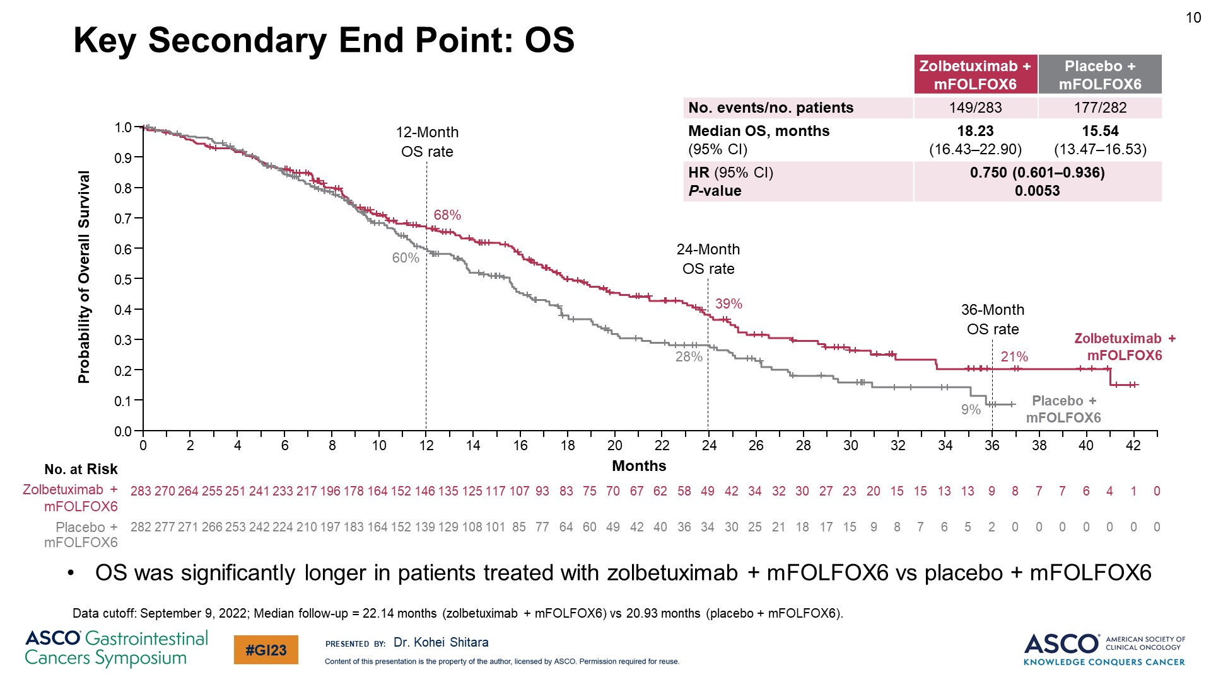
Key Secondary End Point: OS
Content of this presentation is the property of the author, licensed by ASCO. Permission required for reuse.

Slide 68
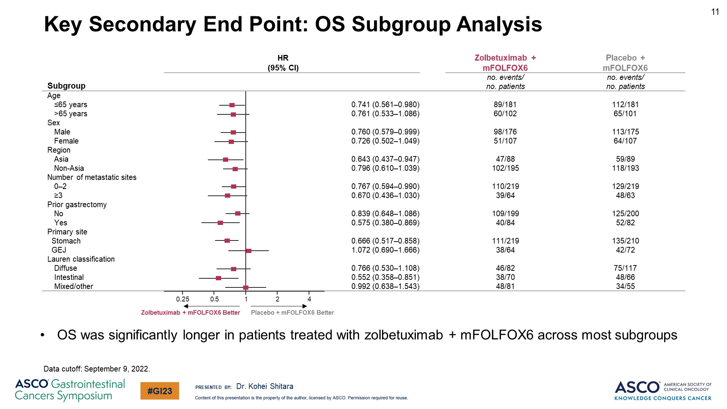
Key Secondary End Point: OS Subgroup Analysis
Content of this presentation is the property of the author, licensed by ASCO. Permission required for reuse.

Slide 69
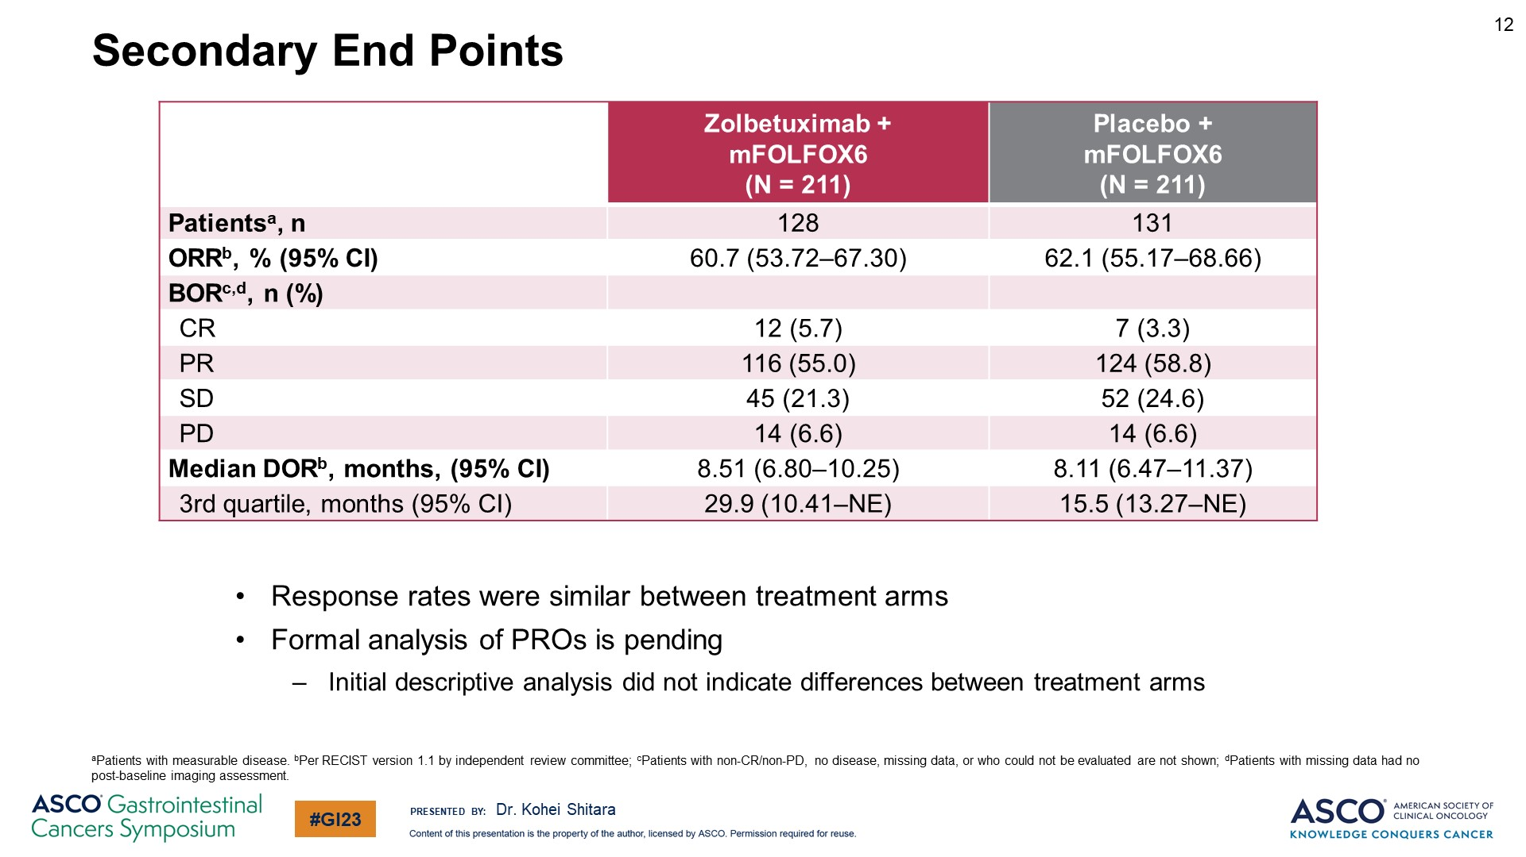
Secondary End Points
Content of this presentation is the property of the author, licensed by ASCO. Permission required for reuse.

Slide 70
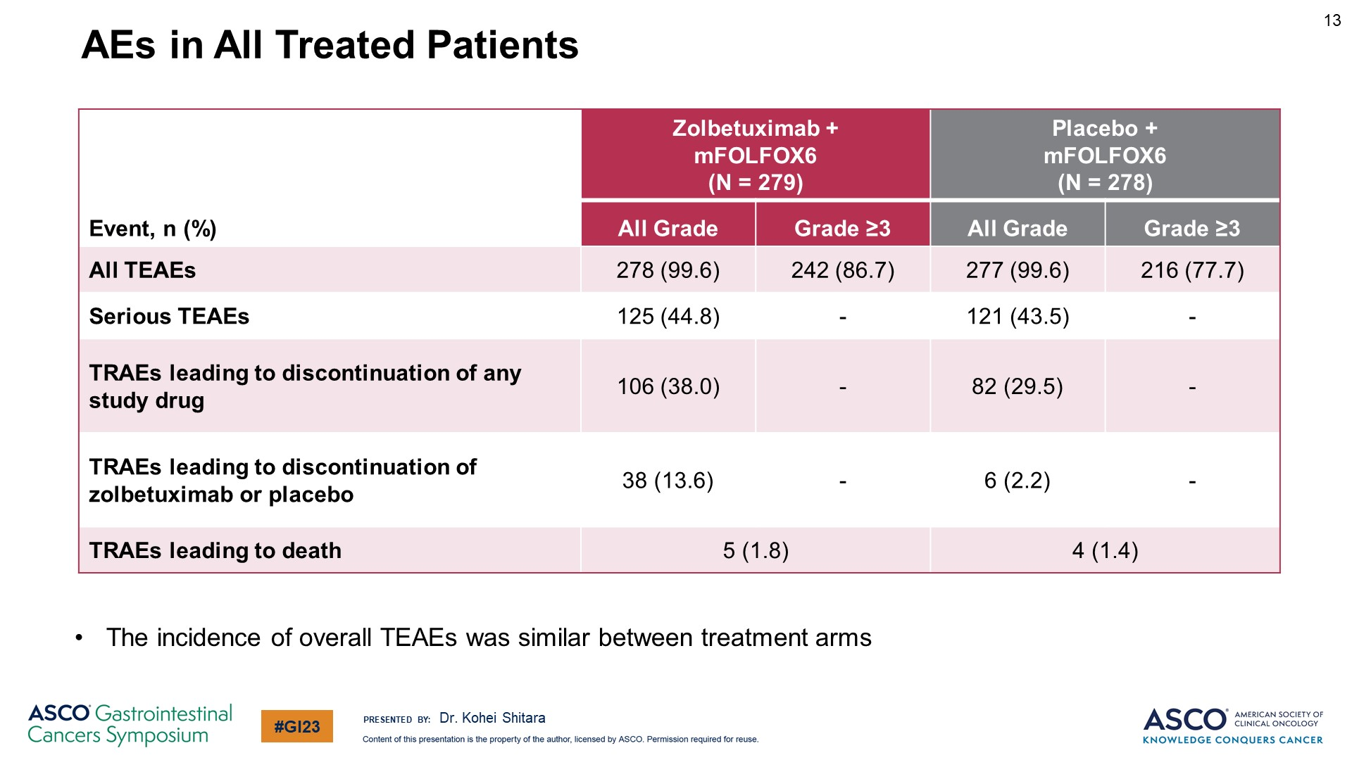
AEs in All Treated Patients
Content of this presentation is the property of the author, licensed by ASCO. Permission required for reuse.

Slide 71
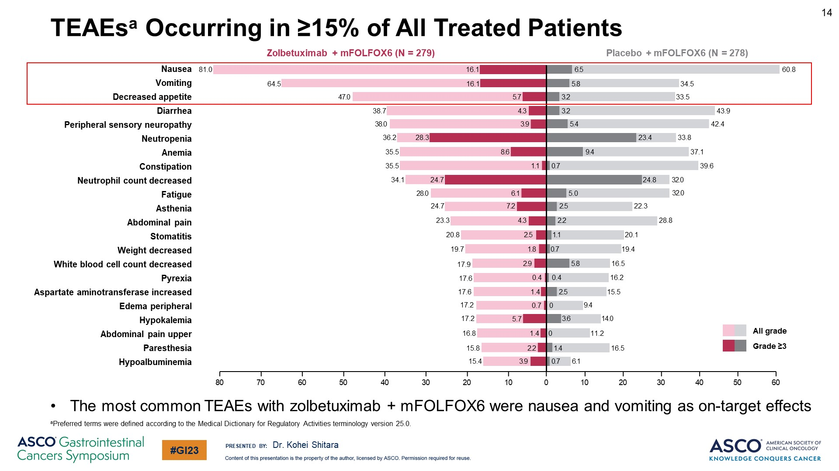
TEAEsa Occurring in ≥15% of All Treated Patients
Content of this presentation is the property of the author, licensed by ASCO. Permission required for reuse.

Slide 72
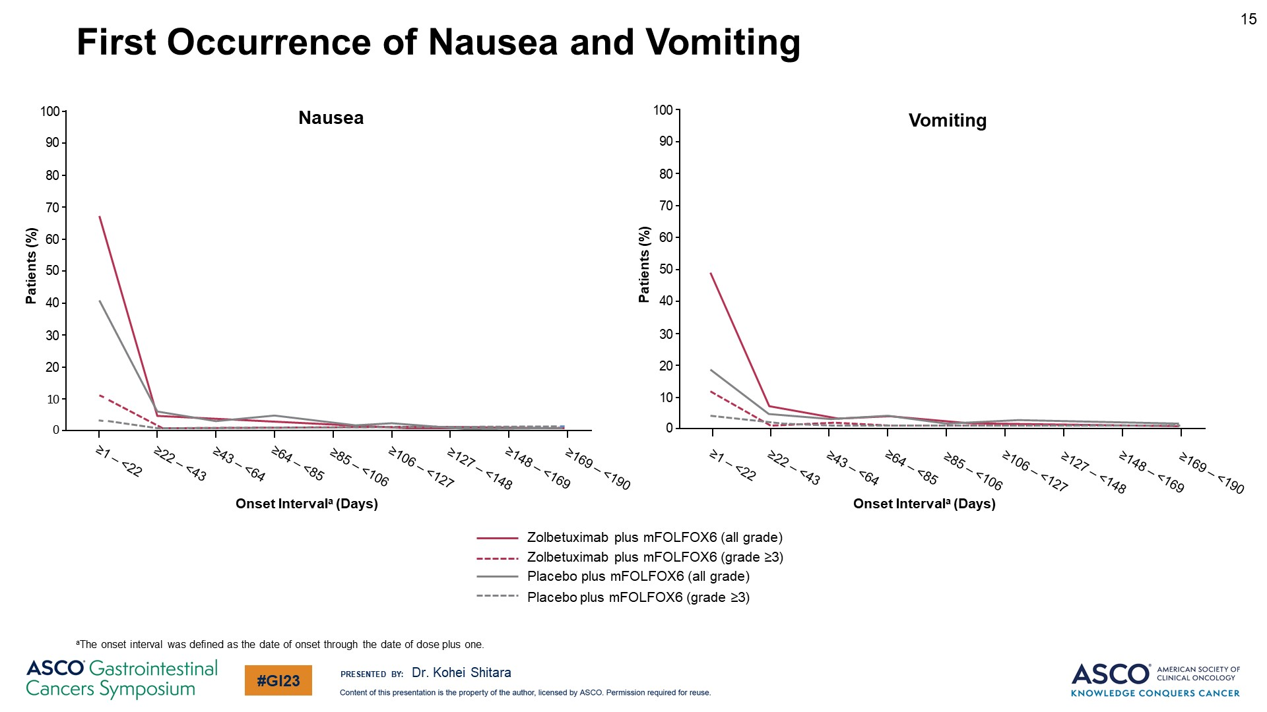
First Occurrence of Nausea and Vomiting
Content of this presentation is the property of the author, licensed by ASCO. Permission required for reuse.

Slide 73
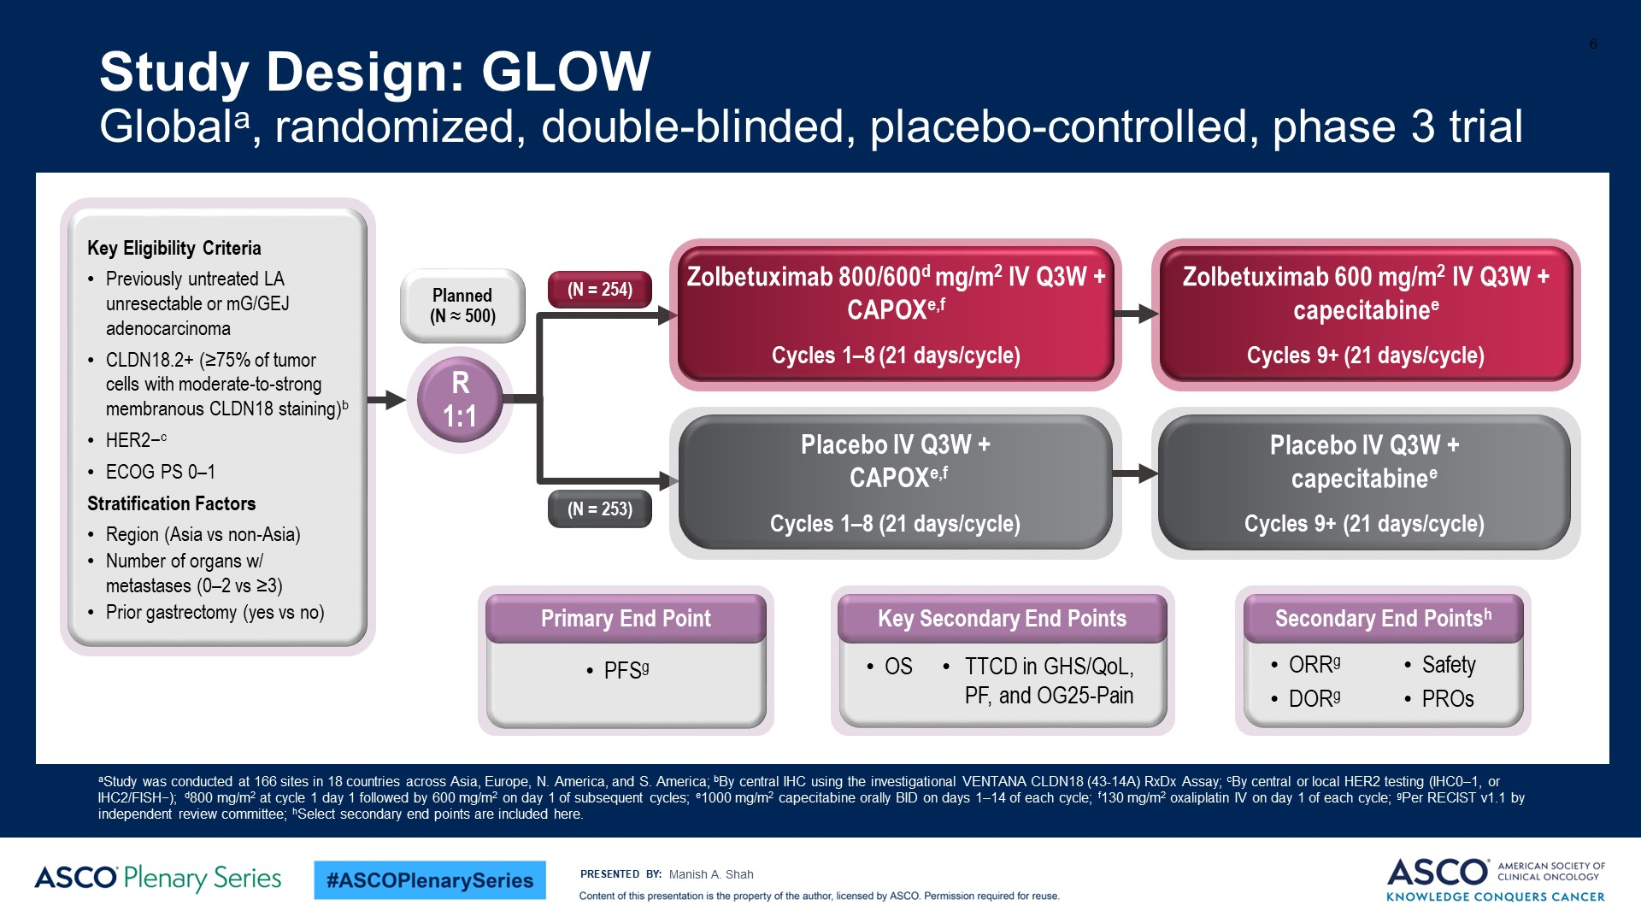
Study Design: GLOW<br />Globala, randomized, double-blinded, placebo-controlled, phase 3 trial
Shah Nature Medicine 29: 2133; 2023
Content of this presentation is the property of the author, licensed by ASCO. Permission required for reuse.

Slide 74
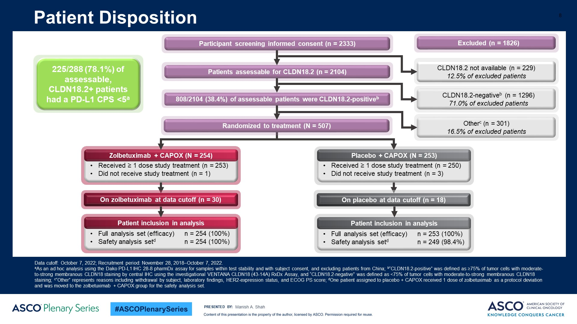
Patient Disposition<br /><br />
Content of this presentation is the property of the author, licensed by ASCO. Permission required for reuse.

Slide 75
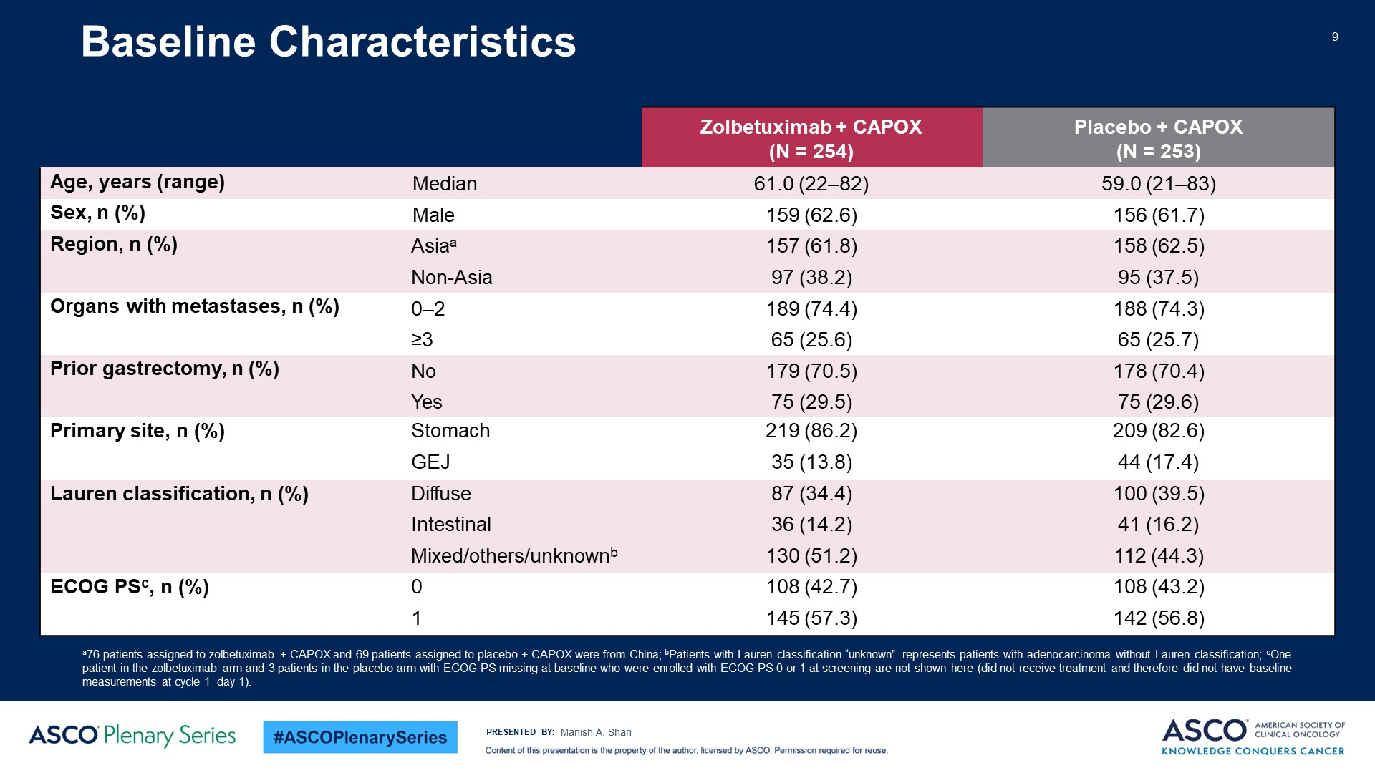
Baseline Characteristics<br /><br />
Content of this presentation is the property of the author, licensed by ASCO. Permission required for reuse.

Slide 76
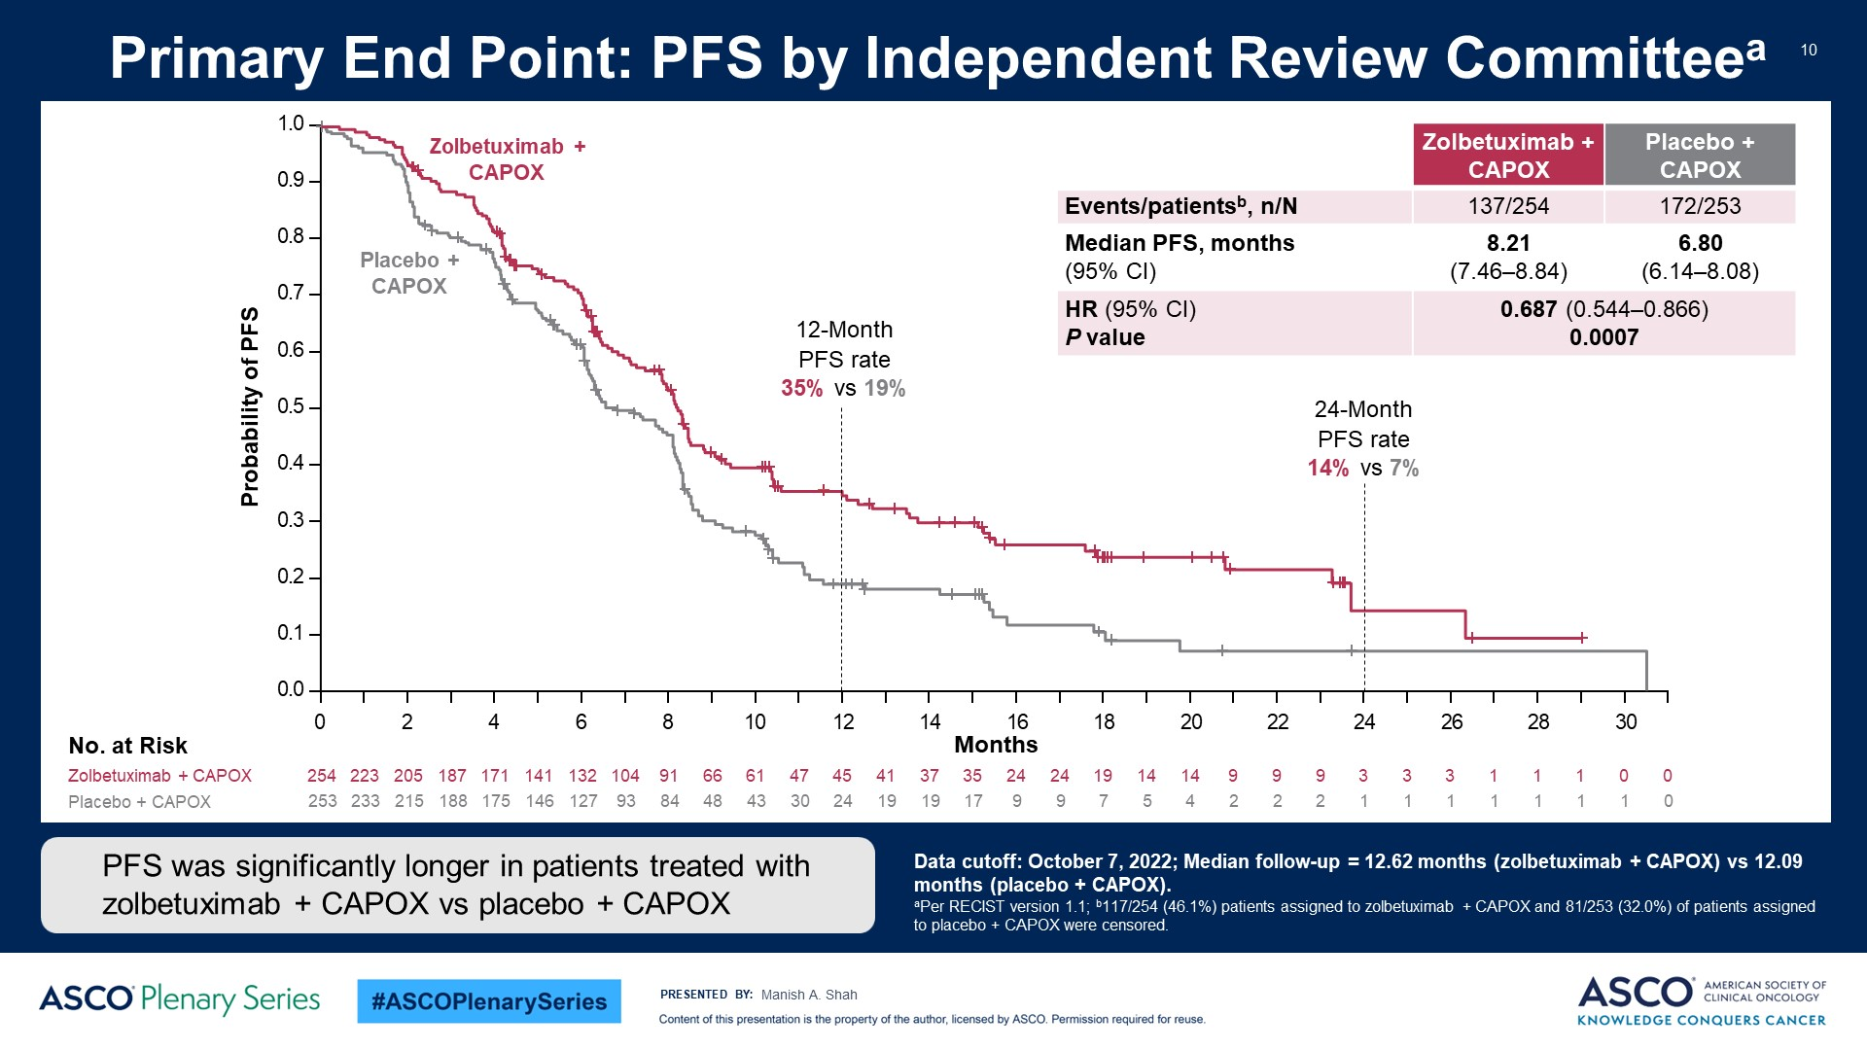
Primary End Point: PFS by Independent Review Committeea<br /><br />
Content of this presentation is the property of the author, licensed by ASCO. Permission required for reuse.

Slide 77
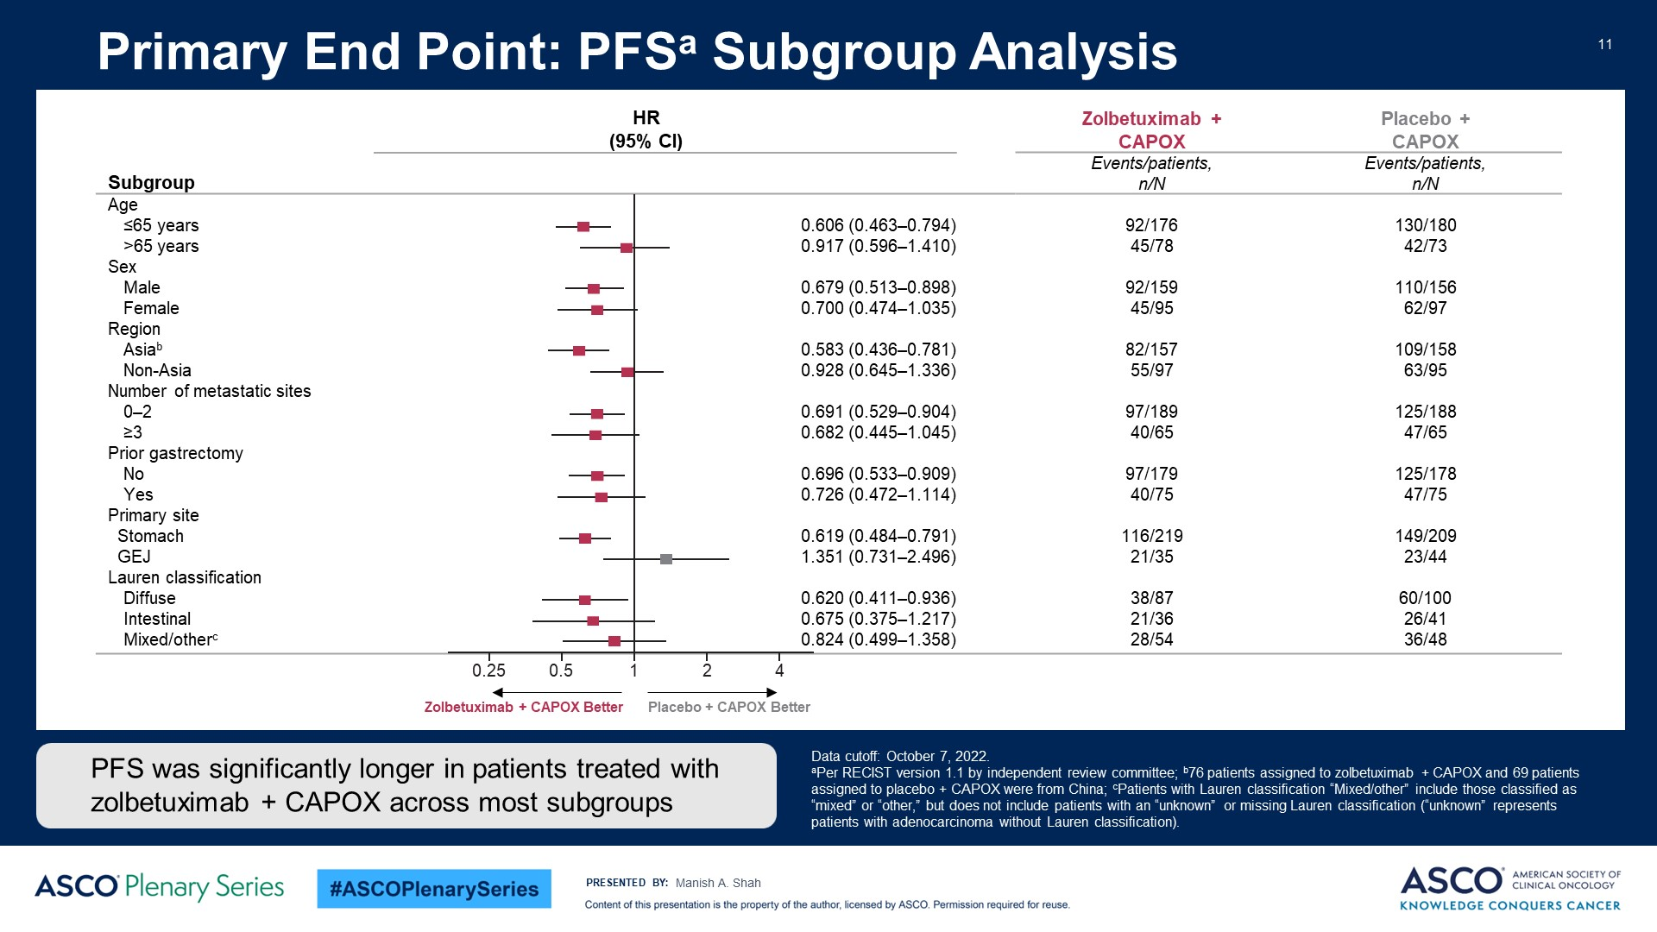
Primary End Point: PFSa Subgroup Analysis<br /><br />
Content of this presentation is the property of the author, licensed by ASCO. Permission required for reuse.

Slide 78
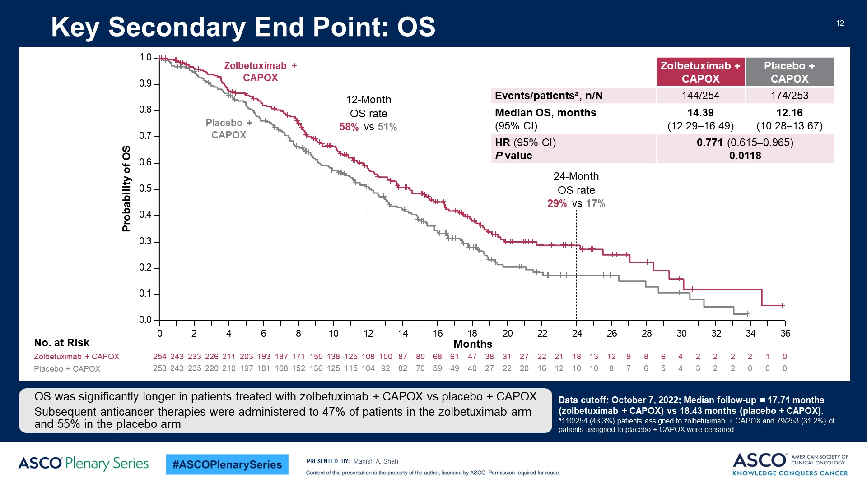
Key Secondary End Point: OS<br /><br />
Content of this presentation is the property of the author, licensed by ASCO. Permission required for reuse.

Slide 79
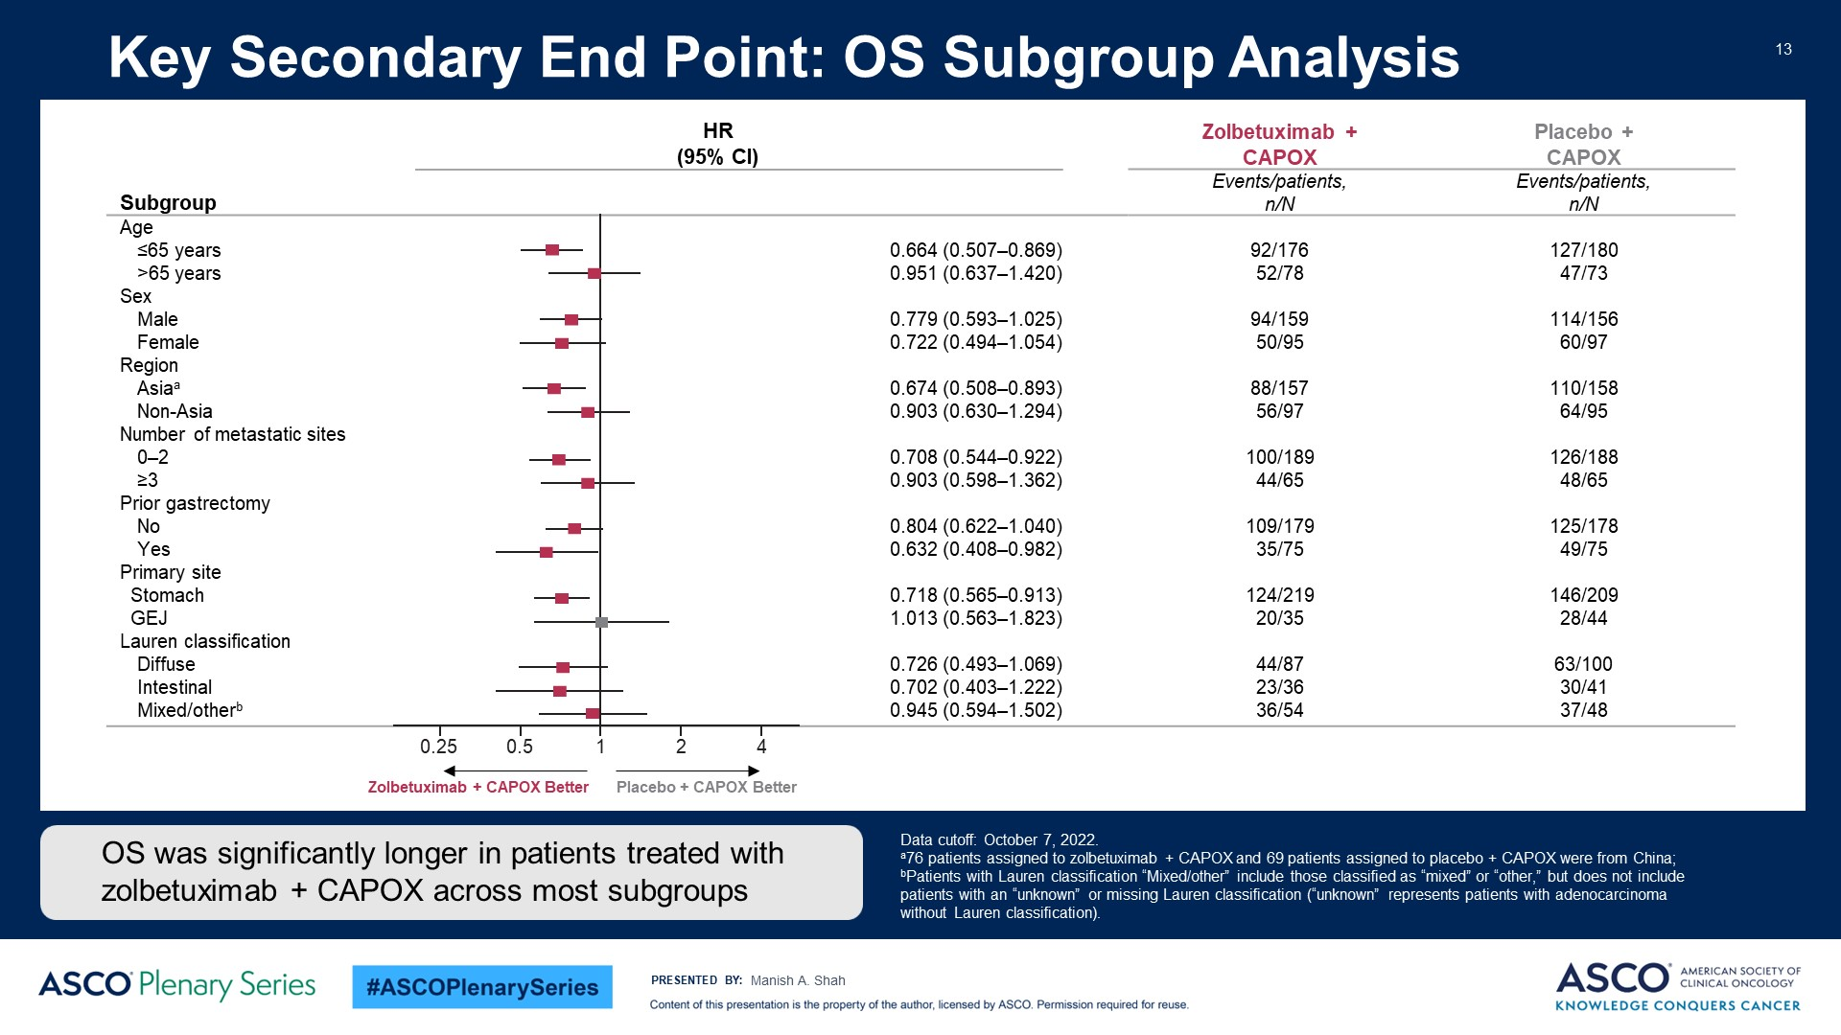
Key Secondary End Point: OS Subgroup Analysis<br /><br />
Content of this presentation is the property of the author, licensed by ASCO. Permission required for reuse.

Slide 80
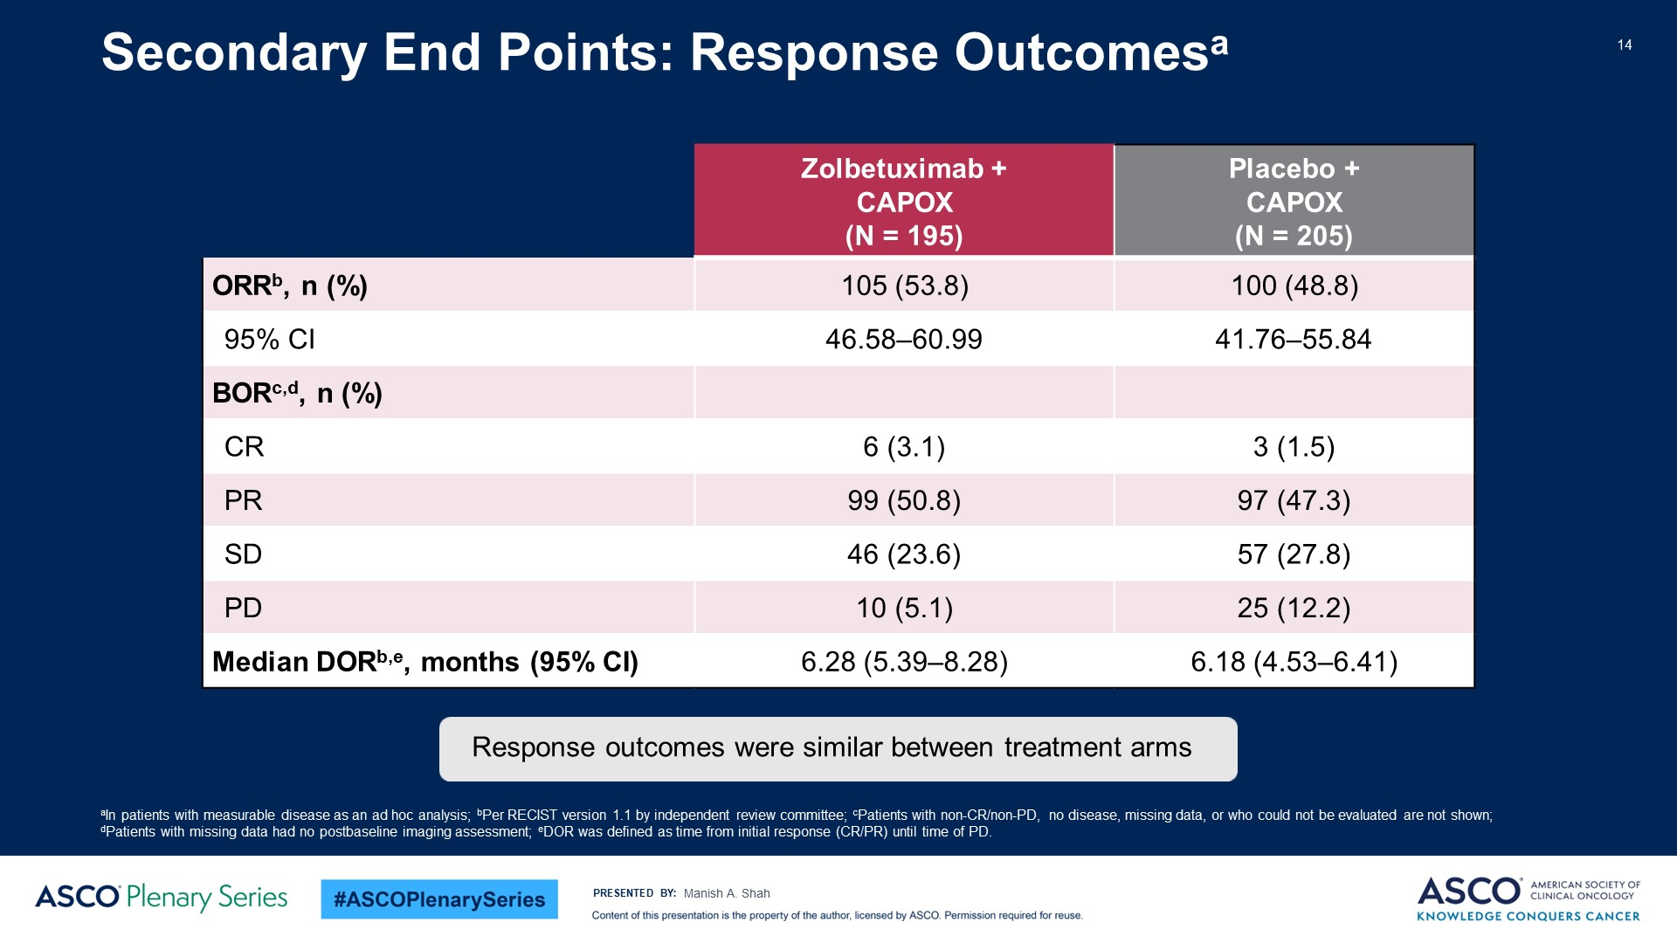
Secondary End Points: Response Outcomesa<br /><br />
Content of this presentation is the property of the author, licensed by ASCO. Permission required for reuse.

Slide 81
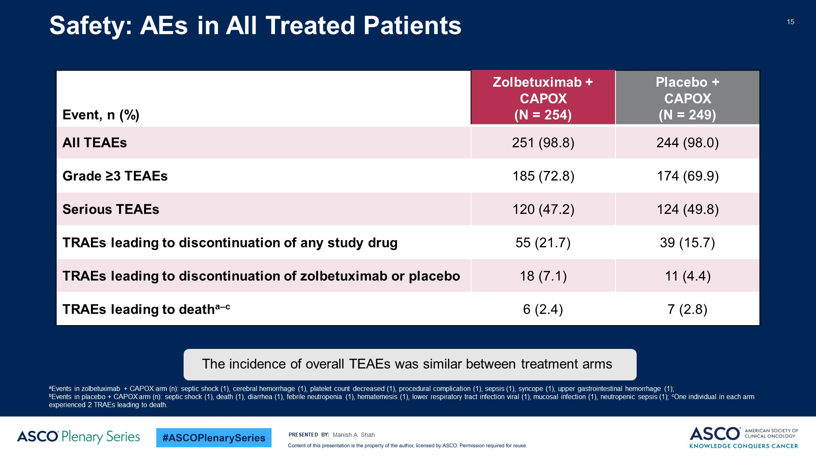
Safety: AEs in All Treated Patients<br /><br />
Content of this presentation is the property of the author, licensed by ASCO. Permission required for reuse.

Slide 82
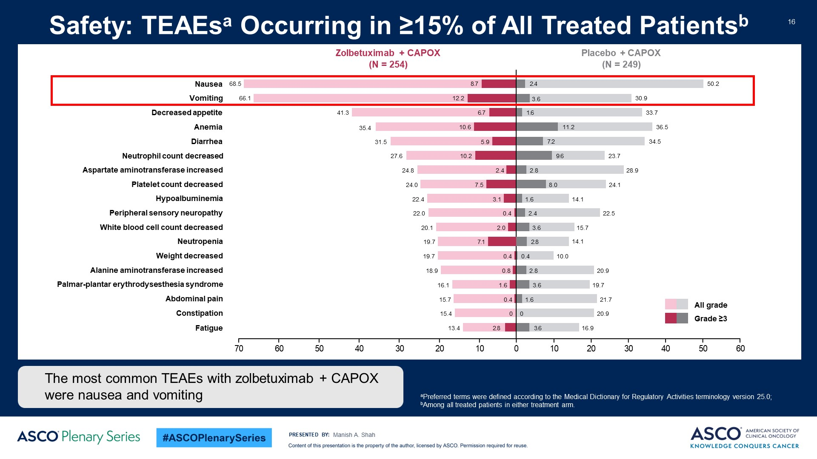
Safety: TEAEsa Occurring in ≥15% of All Treated Patientsb<br /><br />
Content of this presentation is the property of the author, licensed by ASCO. Permission required for reuse.

Slide 83
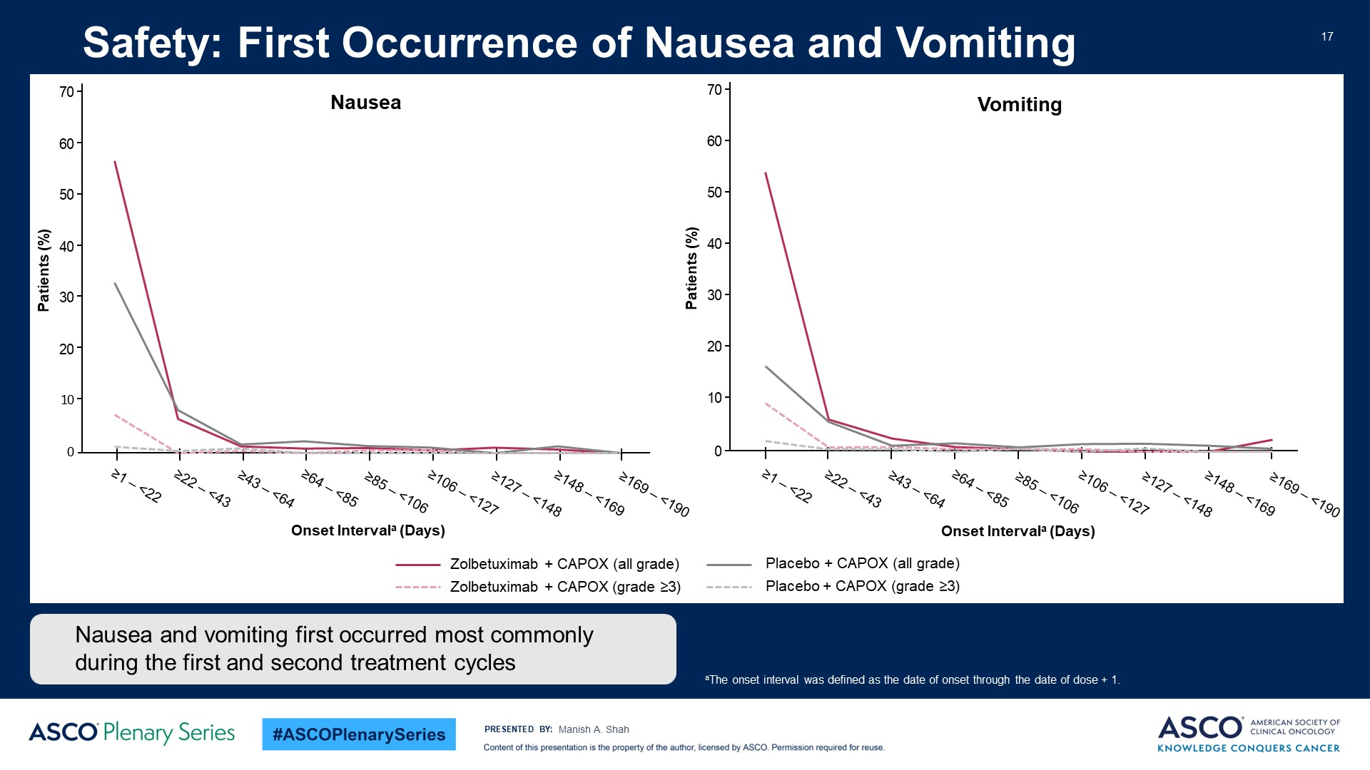
Safety: First Occurrence of Nausea and Vomiting<br /><br />
Content of this presentation is the property of the author, licensed by ASCO. Permission required for reuse.

Slide 84
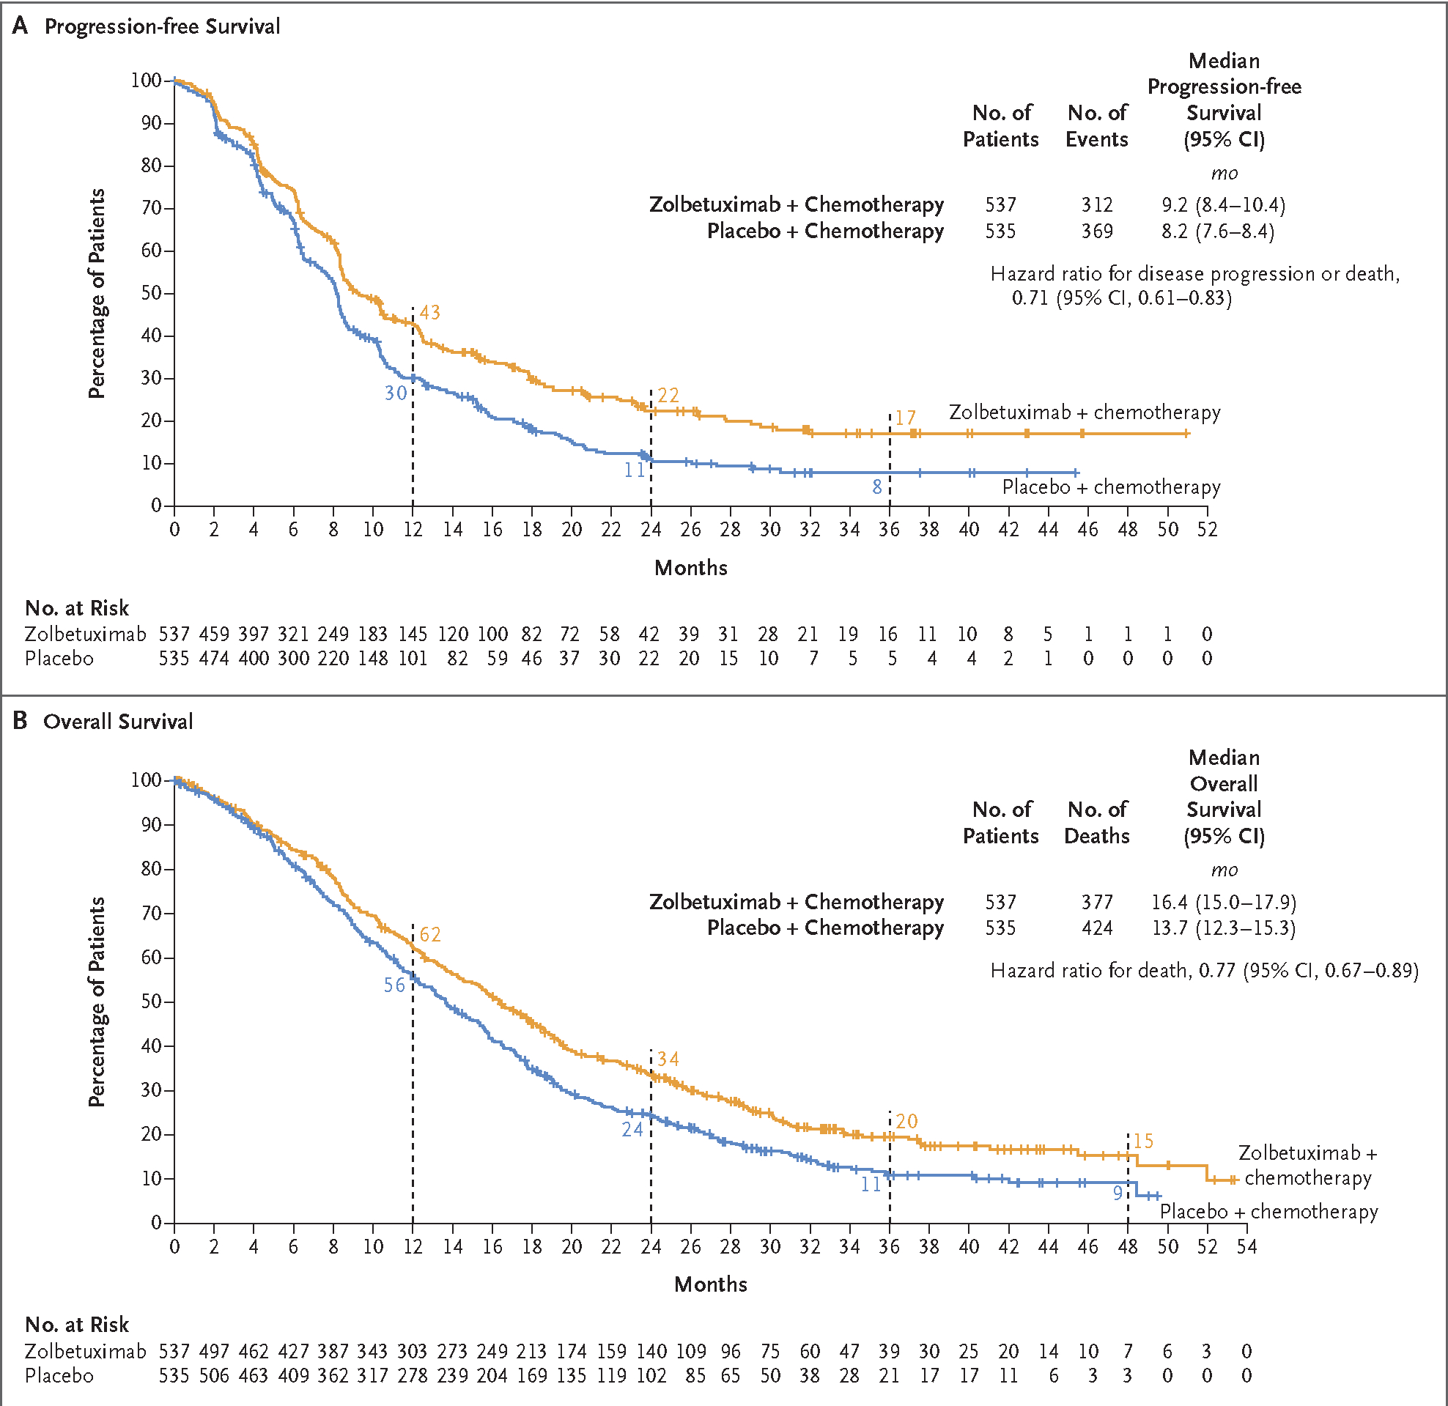
Pooled PFS and OS Results for SPOTLIGHT and GLOW
Shitara NEJM 391: 1159; 2024

Slide 85
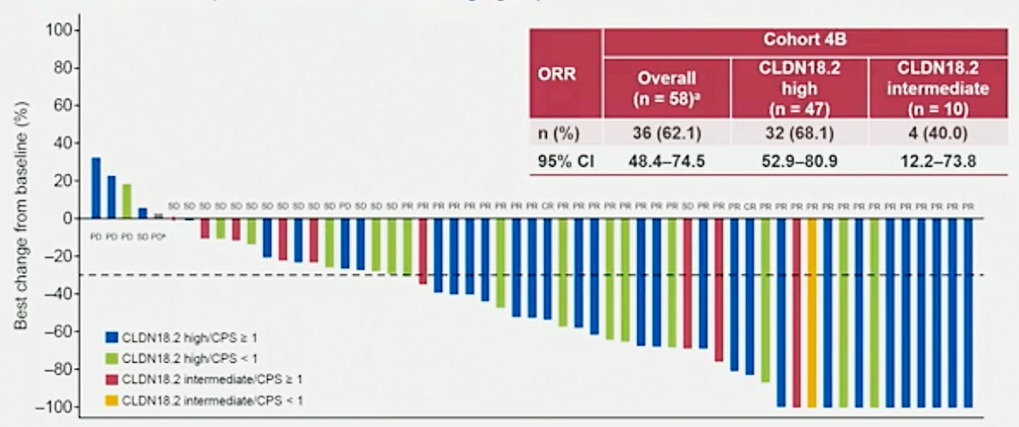
ILUSTRO: First Line Zolbetuximab + Nivolumab + mFOLFOX6
Median PFS: 14.8 months
Shitara ASCO Gastrointestinal Cancers Symposium 2026; Abstract LBA284.

Slide 86
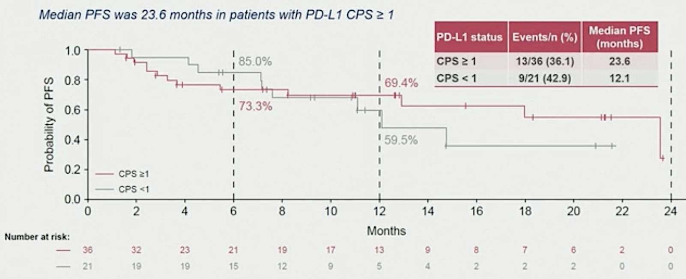
ILUSTRO: First Line Zolbetuximab + Nivolumab + mFOLFOX6
(CLDN 18.2-high population)
Shitara ASCO Gastrointestinal Cancers Symposium 2026; Abstract LBA284.

Slide 87
Ongoing CLDN18.2 Development
LUCERNA (NCT06901531): First line FOLFOX CAPOX/Pembro + / - Zolbetuximab
ZELDA: Second Line Chemo + / - Zolbetuximab
CLARITY (NCT06346392): Second or later line phase 3: CLDN18.2 ADC AZD0901 vs Pac/Ram or MD choice
First Line CLDN18.2 ADC AZD0901 + FU + Rilvegostomig (TIGIT/PD-1)
Novel CLDN18.2 targets
  Bispecifics
    Givastomig: targets CLDN18.2 and 41BB (T cells, agonist)
    16% response in phase 1/2 in GE cancer
    + FOLFOX/Nivo, safe and tolerable
Ku CCR 31: 494; 2025 Klempner ESMO 2025

Slide 88
Conclusions
CLDN18.2 high expression > = 75% seen in 25%, similar across molecular subtypes and PDL-1 expression
  No impact on OS/PFS in first or second-line chemo
Zolbetuximab is approved first line in CLDN18.2 + > = 75% + chemo
  Nausea/Vomiting significant and requires attentive management
Zolbetuximab First line phase 3 + FOLFOX-CAPOX/Pembro is ongoing
Ongoing development
  ADC’s in phase 2-3, earlier line development
  Novel constructs, CART cells
  Exploration in neoadjuvant/adjuvant therapy

Slide 89
Questions from General Medical Oncologists —
Targeting CLDN18.2 in Advanced GE Cancers
82 y/o M with metastatic gastric cancer and high CLDN18.2. Started FOLFOX + zolbetuximab. Used maximal antinausea regimen along with olanzapine. He has not had any nausea. When can antinausea meds be de-escalated?
62 y/o male had FLOT and esophagectomy. Cancer recurred a few months after surgery. He had zolbetuximab and low-dose FOLFOX. He tolerated treatment well, but no response. Can zolbetuximab be combined with FOLFIRI? Can it be given as second-line treatment?
58 y/o woman with HTN, Stage IV gastric cancer, s/p gastrectomy for previous bleeding ulcer 10 yrs ago, CLDN 18.2+ and PD-L1 5%. Would you offer zolbe + chemo?

Slide 90
Questions from General Medical Oncologists —
Targeting CLDN18.2 in Advanced GE Cancers
39-year-old woman with HER2-neg, PD-L1 CPS 0, Claudin 18.2 80% GEJ cancer with Grade 3 nausea on zolbetuximab. How can we give zolbetuximab so it is less emetogenic?
Can zolbetuximab first loading dose preemptively be split into 2 days to minimize severe nausea/vomiting, like we give amivantamab IV infusion?
59 y/o M with CLDN18.2-high gastric cancer, developed PE after 1 cycle of front-line zolbetuximab/FOLFOX. Is it safe to resume zolbetuximab after the pt is fully anticoagulated?

Slide 91
Questions from General Medical Oncologists —
Targeting CLDN18.2 in Advanced GE Cancers
67 y/o male with Stage 4 metastatic GEJ adenocarcinoma, PD-L1 CPS 0, HER2, Claudin 18.2 more than 75%. We are planning to give zolbetuximab plus FOLFOX now. Any pearls for management of nausea? Can you specify your antiemetic regimen with zolbetuximab?
In the 3 patients I treated with zolbetuximab, I have found lorazepam to help with nausea more than anything else. Have you seen this? Any rationale?

Slide 92
Questions from General Medical Oncologists —
Targeting CLDN18.2 in Advanced GE Cancers
48 y/o female with diffuse poorly differentiated Stage 4 gastric adenocarcinoma, PD-L1 CPS 4, claudin 18.2 more than 75%. Pt is very sick and in need of palliative systemic tx ASAP. Should I give zolbetuximab + chemo, or should I still to give IO + chemo?
55-year-old male with metastatic gastric cancer (peritoneal mets). Biopsy shows HER2 IHC 3+, PD-L1 CPS 10, CLDN18.2+. If patient is candidate for 1L HER2-directed tx and zolbetuximab, which is preferred and how do experts make treatment decisions?

Slide 93
Agenda
Module 1: HER2-Targeted Approaches for Advanced Gastroesophageal Cancers — Dr Ajani
Module 2: Targeting Claudin 18.2 in Advanced Gastroesophageal Cancers —
Dr Strickler
Module 3: Optimal Incorporation of Immunotherapeutic Strategies into Treatment for Patients with Metastatic Gastroesophageal Tumors —
Dr Mehta
Module 4: Other Novel Agents and Strategies Under Evaluation for Advanced Gastroesophageal Cancers — Dr Klempner

Slide 94
Optimal Incorporation of Immunotherapeutic Strategies into Treatment for Patients with Metastatic Gastroesophageal Tumors
Rutika Mehta MD, MPH
Associate Professor, Division of Hematology/Oncology
Weill Cornell Medicine/New York Presbyterian Hospital
New York, NY

Slide 95
Agenda
Clinical and biological factors affecting the choice of up-front therapy for patients with metastatic gastroesophageal cancers
Published datasets demonstrating the efficacy and safety of first-line nivolumab-, pembrolizumab- and tislelizumab-containing regimens for advanced HER2-negative gastric, GEJ and esophageal cancers; impact of PD-L1 expression on outcomes
Long-term follow-up with the addition of pembrolizumab to chemotherapy and trastuzumab for previously untreated HER2-positive advanced gastric/GEJ adenocarcinoma; impact of PD-L1 status on outcomes
Clinical utility, if any, of immunotherapy for relapsed/refractory gastroesophageal tumors

Slide 96
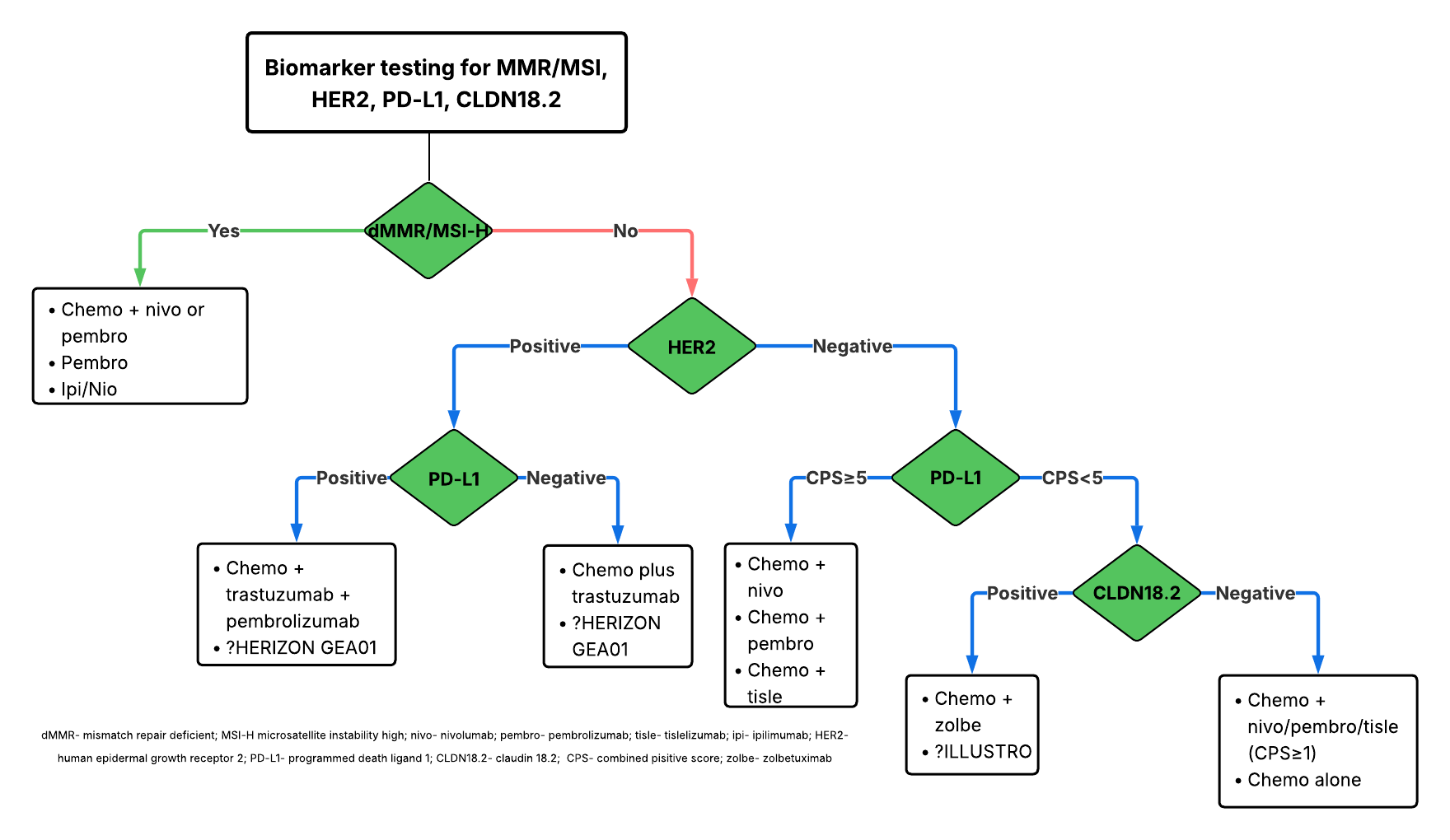
Approach to 1L treatment of gastroesophageal cancers
Ipi/Nivo
positive
Janjigian Y et al. The Lancet 2021; Chao J. JAMA Oncol 2021; Rha S et al, The Lancet Oncol 2023; Qiu MZ et al. BMJ 2024; Janjigian Y et al. NEJM 2024; Shitara K et al. The Lancet 2023; Shah MA et al. Nat Med 2023.

Slide 97
Choice of chemotherapy
Typically doublet of fluoropyrimidine and platinum
  Either capecitabine or 5-fluorouracil
  Oxaliplatin preferred over cisplatin
In case of oligometastatic disease, no actionable biomarkers and potentially eligible for resection of primary and metastatic site- then can consider FLOT (triplet regimen of 5-fluorouracil, oxaliplatin and docetaxel).
Ongoing clinical trial comparing FOLFOX +/- nivo vs FOLFIRINOX +/- nivo in Alliance A022102
Cunningham D et al. N Engl J Med 2008; Park H et al. J Clin Oncol 2023

Slide 98
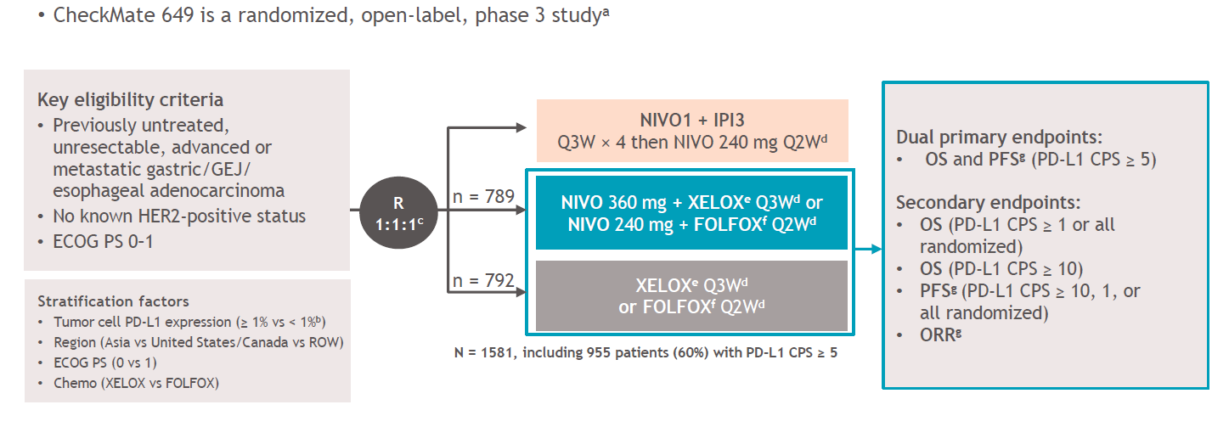
CheckMate-649
70%- GASTRIC; 16-17%- GEJ; 13-14%- EAC
Moehler et al. Annals of Oncology. 2020

Slide 99


Demographics
Janjigian Y et al. J Clin Oncol 2024

Slide 100

Overall response rate
Janjigian Y et al. J Clin Oncol 2024

Slide 101

Addition of nivolumab improves OS
PD-L1 CPS ≥5
All randomized patients
Janjigian Y et al. J Clin Oncol 2024

Slide 102

Addition of nivolumab improves PFS
PD-L1 CPS ≥5
All randomized patients
Janjigian Y et al. J Clin Oncol 2024

Slide 103

KEYNOTE-859
Rha SY et al. Lancet Oncol 2023

Slide 104


Demographics
80% patients had gastric cancer; ~35% patients had diffuse gastric cancer
Rha SY et al. Lancet Oncol 2023

Slide 105

Overall response rate
Rha SY et al. Lancet Oncol 2023

Slide 106



Addition of pembrolizumab improves OS
Intention-to-treat population
PD-L1 CPS ≥1
PD-L1 CPS ≥10
Rha SY et al. Lancet Oncol 2023

Slide 107



Addition of pembrolizumab improves PFS
Intention-to-treat population
PD-L1 CPS ≥1
PD-L1 CPS ≥10
Rha SY et al. Lancet Oncol 2023

Slide 108

RATIONALE-305
Moehler et al. ASCO GI 2023

Slide 109

Demographics
TAP score, defined as total percentage of tumor area (tumor and any desmoplastic stroma) covered by tumor cells with PD-L1 membrane staining (any intensity), and tumor associated immune cells with PD-L1 staining (any intensity), visually estimated by pathologists using an investigational use only version of the Ventana PDL1 (SP263) assay (Roche Diagnostics)
CPS and TAP overall agreement 82%
Qiu MZ et al. BMJ 2024

Slide 110

ORR, DCR and DoR
Qiu MZ et al. BMJ 2024

Slide 111


Addition of tislelizumab showed OS benefit
In TAP ≥5%, median OS with C+ tisle vs C alone was 17.2 mos vs 12.6 mos (HR 0.74; p=0.006)
In all randomized patients, median OS with C+ tisle vs C alone was 15.0 mos vs 12.9 mos (HR 0.80; p=0.001)
Qiu MZ et al. BMJ 2024

Slide 112


Addition of tislelizumab showed PFS benefit
In TAP ≥5%, median PFS of C + tisle vs C alone was 7.2 mos vs 5.9 mos (HR 0.67; p<0.001)
In all randomized patients, median PFS of C + tisle vs C alone was 6.9 mos vs 6.2 mos (HR 0.67; p<0.001)
Qiu MZ et al. BMJ 2024

Slide 113


Chemo plus tislelizumab better than chemo regardless of peritoneal metastasis
OS in patients without peritoneal metastasis
OS in patients with peritoneal metastasis
Qiu M et al. J Clin Oncol (2025)

Slide 114

KEYNOTE-811: 1L HER2-POS mGC/GEJ
Janjigian et al. JCO. 2021

Slide 115

KEYNOTE-811
Janjigian et al. JCO. 2021

Slide 116

KEYNOTE-811
Janjigian et al. JCO. 2021

Slide 117


KEYNOTE-811 assessing addition of pembrolizumab to chemotherapy plus trastuzumab in HER2 positive gastroesophageal cancers
Previously shown to improve ORR with addition of pembrolizumab and combination was FDA approved in 2021.
The overall survival benefit of adding pembrolizumab was limited to PD-L1 CPS ≥1 patients
Janjigian Y et al. Lancet 2023

Slide 118


Pembrolizumab improves PFS in 1L HER2 pos
10.0 mos
10.9 mos
8.1 mos
7.3 mos
All randomized patients
PD-L1 CPS ≥1
Janjigian Y et al. Lancet 2023

Slide 119

CAR-T therapy in refractory gastric cancer
Qi. ASCO 2025

Slide 120



Results
Qi. ASCO 2025

Slide 121


Immunotherapy in refractory settings
efficacy of OBP-301 in
OBP-301 is a novel, replication-selective adenoviral construct that incorporates the hTERT promoter to regulate the expression of the early adenoviral genes, E1A and E1B.
Three of 16 patients (19%) had a partial response.
A formal Phase 2 study is currently enrolling (NCT06340711).
Shah MA et al. J Clin Oncol 2023

Slide 122
Conclusions
Key biomarkers MMR/MSI, HER2, PD-L1, CLDN18.2 dictate standard 1L treatment for advanced/metastatic gastroesophageal adenocarcinomas.
Doublet chemotherapy is preferred over triplet combination.
Nivolumab, pembrolizumab and tislelizumab have all shown improvement in OS and PFS when added to chemo. Incremental benefit seen with higher PD-L1 cut-offs.
In 1L HER2 positive patients, addition of pembrolizumab to chemo plus trastuzumab is limited to PD-L1 CPS ≥1 patients.
Limited benefit of checkpoint inhibitors in refractory settings. But, oncolytic viruses and cellular therapies being explored.

Slide 123
Questions from General Medical Oncologists —
Incorporation of Immunotherapeutic Strategies into
Treatment of Metastatic GE Tumors
72 y/o with CHF and stage IV esophageal SCC, PD-L1 7, treated with FOLFOX and nivolumab. What is the minimum PD-L1 level for using an ICI for both SCC and adenocarcinoma?
60M with squamous gastric cancer (not GEJ) PD-L1 85%. Started FOLFOX plus nivolumab, excellent response gaining weight, disease shrinking. How would you compare the sensitivity to ICI of squamous gastric cancer versus GEJ cancer?

Slide 124
Questions from General Medical Oncologists —
Incorporation of Immunotherapeutic Strategies into
Treatment of Metastatic GE Tumors
70-year-old man with a history of hypertension, Type 2 DM with peripheral neuropathy and mild COPD presents with dysphagia, weight loss, and fatigue. Imaging: multiple liver metastases, enlarged perigastric nodes. ECOG performance status 2. Endoscopy and biopsy: gastric adenocarcinoma, intestinal type HER2-negative, PD-L1 CPS = 25, MSI-stable. What treatment would you most likely recommend?

Slide 125
Questions from General Medical Oncologists —
Incorporation of Immunotherapeutic Strategies into
Treatment of Metastatic GE Tumors
Age: 62, Sex: Male, Diagnosis/stage: Metastatic GEJ adenocarcinoma (liver mets), HER2-negative, PD-L1 CPS 10. Comorbidities: Diabetes, mild CKD. Major therapies: Newly diagnosed – planning FOLFOX + nivolumab. At what PD-L1 CPS threshold is the benefit of adding checkpoint inhibitor to chemotherapy clinically meaningful?

Slide 126
Questions from General Medical Oncologists —
Incorporation of Immunotherapeutic Strategies into
Treatment of Metastatic GE Tumors
79-year-old woman with HER2 positive GEJ cancer, PD-L1 CPS 30, also has a history of moderately controlled rheumatoid arthritis. What is the threshold of autoimmune disease that would impact the use of immunotherapy?
60F (ECOG 0) with Crohn’s disease (not on any steroids or biologics and without any flares in 20+ yrs) and metastatic gastric adenocarcinoma, PDL1 55%, HER2 1+. Pending 1st line treatment. Would you offer FOLFOX + immunotherapy for a tumor with a high PD-L1 score given the patient’s dormant IBD? How do you discuss immune therapy in patient with auto-immune disease and other co-morbid conditions?

Slide 127
Questions from General Medical Oncologists —
Incorporation of Immunotherapeutic Strategies into
Treatment of Metastatic GE Tumors
48 y/o F with metastatic gastric cancer, Claudin 18.2 positive, PD-L1 CPS is
12. What would be the better frontline therapy – FOLFOX/zolbetuximab versus FOLFOX/nivolumab?
63 y/o female pt was treated with FOLFIRI x 5 cycles in Japan, with progressive disease, then transferred here, found to be PD-L1 CPS 5,
HER2 1+, and Claudin 18.2 more than 75%. Should I give FOLFOX/nivolumab or FOLFOX/zolbetuximab?
47 yr old male with Stage 4 gGEJ cancer with Claudin 18.2 of 80% and PD-L1 score of 5. How do we choose between targeting claudin vs IO?

Slide 128
Questions from General Medical Oncologists —
Incorporation of Immunotherapeutic Strategies into
Treatment of Metastatic GE Tumors
59 y/o man with Type 2 DM and Stage IV gastric adenocarcinoma, PD1 20%, TMB 10, but pt refuses chemo. Would you offer single agent anti-PD1 antibody?

Slide 129
Agenda
Module 1: HER2-Targeted Approaches for Advanced Gastroesophageal Cancers — Dr Ajani
Module 2: Targeting Claudin 18.2 in Advanced Gastroesophageal Cancers —
Dr Strickler
Module 3: Optimal Incorporation of Immunotherapeutic Strategies into Treatment for Patients with Metastatic Gastroesophageal Tumors —
Dr Mehta
Module 4: Other Novel Agents and Strategies Under Evaluation for Advanced Gastroesophageal Cancers — Dr Klempner

Slide 130

Other Novel Agents and Strategies Under Evaluation for Advanced Gastroesophageal Cancers
Samuel J. Klempner, MD, FASCO
MGB Cancer Institute
Boston, MA

Slide 131
Overview
Doubling Down on Checkpoint Inhibitors with TIGIT + PD-1
What About Bispecific Dual Checkpoint Blockade with PD-1xTIGIT
Getting More from CLDN18.2 with Antibody Drug Conjugates
ADCs for Other Antigens and New Targets

Slide 132


Starting in the Clinic
HPI: 67M with limited PMH presents with increasing food sticking and 10lb weight loss.
PET-CT: Diffuse bilobar hepatic mets, widespread lymphadenopathy
PATHOLOGY: Liver biopsy with mod-diff adenocarcinoma, pMMR, HER2 IHC 1+, PD-L1+ (CPS = 4), CLDN18.2 2+/3+ in 40% tumor cells

Slide 133


Starting From Biomarkers
~3-5% of stage IV
~15-20% of stage IV
~75-80% of stage IV
~40% of stage IV
PMID: 34795387
Made on Biorender.com

Slide 134

TIGIT RATIONALE
Inhibitory checkpoint on T/NK cell subsets
Suppresses T/NK activation partly by outcompeting CD226/DNAM-1 for shared ligand CD155/PVR
TIGIT expression correlates with PD-1 expression, particularly in tumor-infiltrating cells
PD-1 and TIGIT are frequently co-expressed on putative tumor-specific CD8+ T-cell in gastroesophageal
SITC 2023

Slide 135



Early Enthusiasm for Dual PD-1 + TIGIT
ORR = 59%
TAP <1% = 46%
TAP >1% = 62%
TAP >5% = 69%
mPFS ITT = 12.9m
PMID:
41109921

Slide 136


Early Enthusiasm for Dual PD-1 + TIGIT
12/12/2025: The Phase 3 STAR-221 study evaluating a domvanalimab-based combination in upper gastrointestinal cancers will be discontinued due to futility
mOS ITT = 26.7m
PMID: 41109921

Slide 137

Shifting TIGIT Hopes to Bispecifics: Rilve
GEMINI-Gastric = phase 2 platform study in HER2-negative locally advanced unresectable or metastatic gastric or GEJ adenocarcinoma
STUDY DESIGN
Substudy 1 (n=40)
Volrustomig + XELOX or FOLFOX
Substudy assignment:
For substudies
3 and 4,
patients must have claudin18.2-positive status
Primary
endpoint
Locally advanced unresectable or metastatic
gastric or GEJ adenocarcinoma
HER2-negative tumors
Previously untreated for advanced/ metastatic disease
ECOG PS 0 or 1
Substudy 2 (n=40)
Rilvegostomig + XELOX or FOLFOX
ORR and
6-month PFS§
Substudy 3 (n=40)
AZD0901 + volrustomig
+ 5-FU or capecitabine
Key secondary endpoints
Substudy 4 (n=40)
AZD0901 +rilvegostomig
+ 5-FU or capecitabine
DoR§
PFS (median and 12-month rate)§
Safety and tolerability
Substudy 5 (n=40)
Sabestomig + XELOX or FOLFOX
Rivera F, et al. Presented at: ESMO 2024 [Poster 1422P].

Slide 138
Shifting TIGIT Hopes to Bispecifics: Rilve
Patient demographics
Baseline disease characteristics
Demographic parameter | All patients (N=40)
 | Rilvegostomig + XELOX (n=27) | Rilvegostomig + FOLFOX (n=13)
Age, years, median (range) | 63 (42–79)
<65 years, n (%) | 22 (55.0)
≥65 years, n (%) | 18 (45.0)
Male, n (%) | 23 (57.5)
Race, n (%)
Asian | 29 (72.5)
White | 11 (27.5)
Area of residence, n (%)
Asia* | 29 (72.5)
Western country† | 11 (27.5)
Disease characteristic | All patients (N=40)
 | Rilvegostomig + XELOX (n=27) | Rilvegostomig + FOLFOX (n=13) | Rilvegostomig + FOLFOX (n=13)
ECOG PS, n (%)
0 | 21 (52.5)
1 | 19 (47.5)
Primary tumor location, n (%)
Stomach | 32 (80.0)
GEJ | 8 (20.0)
Metastatic disease, n (%) | 40 (100)‡
Metastatic sites, n (%)
Peritoneum | 16 (40.0)
Liver | 14 (35.0)
Bone | 4 (10.0)
PD-L1 CPS, n (%)
<5 | 22 (55.0)§
≥5 | 16 (40.0)¶
Missing | 2 (5.0)
Data cutoff: 4 July 2024.
*Includes mainland China (n=14), Republic of Korea (n=8), Japan (n=4), and Taiwan (n=3). †Includes Spain (n=8), Great Britain (n=2), and the USA (n=1).
‡One patient had peritoneal metastases resected before enrollment. §Includes one patient with local PD-L1 results. ¶Includes two patients with local PD-L1 results.
CPS, combined positive score; ECOG PS, Eastern Cooperative Oncology Group performance status; FOLFOX, 5-fluorouracil + leucovorin + oxaliplatin;
GEJ, gastroesophageal junction; PD-L1, programmed cell death ligand 1; XELOX, capecitabine + oxaliplatin.
Rivera F, et al. Presented at: ESMO 2024 [Poster 1422P].
Notes:
Reference
Rivera F, Oh D-Y, Shitara K, et al. First-line rilvegostomig plus chemotherapy in patients with HER2-negative locally advanced unresectable or metastatic gastric cancers: First report of GEMINI-Gastric Substudy 2. Presented at: European Society for Medical Oncology (ESMO) Meeting; September 13–17, 2024; Barcelona, Spain [Poster 1422P].

Slide 139

Shifting TIGIT Hopes to Bispecifics: Rilve
The ORR was 62.5% in all patients and 81.3% in patients with a PD-L1 CPS ≥5
Response outcomes
100
PD-L1 CPS ≥5 (n=16)
PD-L1 CPS <5 (n=22)
Missing (n=2)
Outcome | PD-L1 CPS ≥5 (n=16) | PD-L1 CPS <5 (n=22) | All patients (N=40)
Confirmed ORR, % (95% CI) | 81.3 (54.4–96.0) | 50.0 (28.2–71.8) | 62.5 (45.8–77.3)
Best overall confirmed response, n (%)
CR | 2 (12.5) | 0 | 2 (5.0)
PR | 11 (68.8) | 11 (50.0) | 23 (57.5)
uPR | 0 | 2 (9.1) | 2 (5.0)
SD lasting ≥5 weeks | 3 (18.8) | 9 (40.9) | 13 (32.5)
PD | 0 | 0 | 0
DoR for confirmed responses, months, median (95% CI) | 12.2 (3.4–NC) | 5.8 (4.1–7.0) | 5.8 (4.2–NC)
80
60
40
20
*
†
Best change in target lesion size from baseline, %
†
*
*
0
SD
SD
SD
SD
SD
SD
SD
SD
SD
−20
SD
SD
SD
SD
−40
PR
SD
SD
SD
PR
PR
−60
PR
PR
PR
PR
PR
PR
PR
PR
PR
PR
PR
PR
PR
−80
PR
PR
PR
PR
−100
PR
PR
CR
CR
Two patients with a PD-L1 CPS ≥5 had a CR
All patients demonstrated disease control (objective response or SD as the best overall response); none had primary PD
Figure adapted from Rivera F, et al. 2024.
*Patients with local PD-L1 results. †Unconfirmed objective responses.
CI, confidence interval; CPS, combined positive score; CR, complete response; DoR, duration of response; NC, not calculable; ORR, objective response rate;
PD, progressive disease; PD-L1, programmed cell death ligand 1; PR, partial response; SD, stable disease; uPR, unconfirmed partial response.
Rivera F, et al. Presented at: ESMO 2024 [Poster 1422P].
Notes:
Reference
Rivera F, Oh D-Y, Shitara K, et al. First-line rilvegostomig plus chemotherapy in patients with HER2-negative locally advanced unresectable or metastatic gastric cancers: First report of GEMINI-Gastric Substudy 2. Presented at: European Society for Medical Oncology (ESMO) Meeting; September 13–17, 2024; Barcelona, Spain [Poster 1422P].

Slide 140

Frontline Chemo + PD-1xTIGIT Bispecific
Median PFS was 8.3 months in all patients and 11.1 months in patients with PD-L1 CPS ≥5
PFS based on investigator assessment
1.0
0.9
Group | Median PFS (95% Cl), months
PD-L1 CPS ≥5 (n=16) | 11.1 (5.6–NC)
PD-L1 CPS <5 (n=22) | 7.1 (6.1–8.8)
All patients (N=40) | 8.3 (7.0–9.9)
0.8
0.7
0.6
0.5
Probability of PFS
0.4
0.3
0.2
0.1
0.0
0
1
2
3
4
5
6
7
8
9
10
11
12
13
14
15
16
Months from first dose
Patients at risk, n
Events, n
PD-L1 CPS <5
22
22
21
20
20
19
15
11
9
3
0
0
0
0
0
0
0
15
PD-L1 CPS ≥5
16
16
16
16
16
14
9
9
9
7
4
4
3
2
1
1
0
8
All patients
40
40
39
38
38
35
26
22
19
11
4
4
3
2
1
1
0
25
Rivera F, et al. Presented at: ESMO 2024 [Poster 1422P].

Slide 141
Frontline Chemo + PD-1xTIGIT Bispecific
Safety summary for rilvegostomig + chemotherapy
Adverse events of special interest
Patients, n (%) | All patients (N=40)
Treatment-related AEs | 40 (100.0)
Rilvegostomig-related AEs | 25 (62.5)
Treatment-related grade ≥3 AEs | 17 (42.5)
Rilvegostomig-related grade ≥3 AEs | 4 (10.0)
Treatment-related serious AEs | 5 (12.5)
Rilvegostomig-related serious AEs | 1 (2.5)*
Any AE leading to treatment discontinuation | 10 (25.0)
Any AEs leading to discontinuation of rilvegostomig | 1 (2.5)
AESI, n (%) | All patients (N=40)
 | Any grade | Grade ≥3
Infusion-related reaction | 3 (7.5)† | 0
Pneumonitis | 2 (5.0)‡ | 1 (2.5)‡
Rash | 2 (5.0)‡ | 0
Diarrhea | 1 (2.5)‡ | 0
Drug hypersensitivity | 1 (2.5)§ | 0
Hyperthyroidism | 1 (2.5) | 0
Immune-mediated enterocolitis | 1 (2.5)‡ | 0
Immune-mediated thyroiditis | 1 (2.5)‡ | 0
Pruritus | 1 (2.5) | 0
Grade ≥3 rilvegostomig-related AEs occurred in four patients: lipase ↑ (n=2), alkaline phosphatase ↑, platelets ↓, pneumonitis (n=1 each)
The only grade ≥3 rilvegostomig-related AESI reported was pneumonitis, which occurred ~3 months after discontinuation of study treatment
*Two events occurred in one patient: platelet count decreased and pneumonitis. †One event was a grade 2 rilvegostomig-related AE. ‡Rilvegostomig-related events. §Oxaliplatin-related.
AE, adverse events; AESI, adverse event of special interest.
Rivera F, et al. Presented at: ESMO 2024 [Poster 1422P].
Notes:
Reference
Rivera F, Oh D-Y, Shitara K, et al. First-line rilvegostomig plus chemotherapy in patients with HER2-negative locally advanced unresectable or metastatic gastric cancers: First report of GEMINI-Gastric Substudy 2. Presented at: European Society for Medical Oncology (ESMO) Meeting; September 13–17, 2024; Barcelona, Spain [Poster 1422P].

Slide 142

Novel-Novel Combinations to Push Forward
The Phase 3 ARTEMIDE-Gastric 01 study is ongoing, evaluating T-DXd + rilvegostomig + fluoropyrimidine in HER2+ / PD-L1 CPS≥1 GC
Locally advanced or metastatic gastric GEJ
No prior treatment
HER2+ (HER2 3+ or 2+ / ISH positive)
CPS ≥ 1
ECOG PS 0 or 1
Rilve + T-DXd + 5FU / Cape
Endpoints
Primary:
PFS; OS
N = 840
R
1:1:1
Pembro + Trastuzumab +
5FU + FP / CAPOX
Rilve + T-DXd + FP / CAPOX
Shah M, et al. ASCO-GI 2026; submitted, NCT06764875

Slide 143



CLDN18.2 Prevalence and Cut Points
Zolbetuximab cut point
CLDN18.2 1+ in >1% tumor cells
No 2+/3+ Expression
Gastric Cancer 2024, ESMO Open 2024
Maeng C, in revision, ESMO GI

Slide 144

Zolbetuximab in 1L CLDN18.2+ GC/GEJ
4yr OS rate in CM-649 all randomized = 13%, 15% (CPS > 1)
ASCO GI 2025
NEJM 2024

Slide 145


Expanding Beyond Zolbetuximab
Antibody Drug Conjugates
Bispecific Antibodies and BiTEs
Made on Biorender.com
Made on Biorender.com
AZD0901 – CLDN18.2 ADC with MMAE Payload
EO-3021 – CLDN18.2 ADC with MMAE Payload
IBI343 -- CLDN18.2 ADC with TOPO1 Payload
SHR-A1904 -- CLDN18.2 ADC with TOPO1 Payload
Givastomig – CLDN18.2 x 4-1BB bispecific
PT886 – CLDN18.2 x CD47 bispecific
ASP2138 – CLDN18.2 x CD3 BiTE
AZD5863 -- CLDN18.2 x CD3 BiTE

Slide 146


CLDN18.2 ADC Activity in GC/GEJ: AZD0901
AZD0901 (CMG901, sonesitatug vedotin)
CLDN18.2
CLDN18.2
IgG1
MMAE
MMAE
INT-025
(CLDN18.2 humanized Ab)
Global phase III 2L+ CLARITY trial examining AZD0901 vs investigator-choice chemotherapy in CLDN18.2+ GC/GEJ is ongoing (NCT06346392)
Feature | CLDN18.2-high 2.2mg/kg (n = 32) | CLDN18.2-high 2.6mg/kg (n = 45) | CLDN18.2-high 3.0mg/kg (n = 15) | CLDN18.2-high Total (n = 93)
cORR | 47% | 22% | 38% | 33%
mPFS | 4.8 months | 3.3 months | 9.9 months | 4.8 months
mOS | 11.8 months | 11.5 months | 11.1 months | 11.8 months
Lancet Oncology 2025
CLDN18.2 >2+ in 20% tumor cells = CLDN18.2-high

Slide 147


CLARITY-Gastric-01
CLDN18.2 > 1+ in > 25% Tumor cells
Can we move CLDN18.2 ADC into later line therapy? -- TBD
ASCO GI 2025, TPS507

Slide 148

CLDN18.2 ADC Toxicity in GC/GEJ: AZD0901
Toxicity | Grade 1-2 | Grade 3
Decr. Appetite | 42% | 7%
Weight Loss | 55% | 4%
Fatigue | 2% | 0
Alopecia | 8% | 0
Asthenia | 27% | 4%
Toxicity | Grade 1-2 | Grade 3
Pneumonitis | 6% | 0
URI | 6% | 1%
Toxicity | Grade 1-2 | Grade 3
Anemia | 52% | 13%
Low PLTs | 10% | 2%
Neutropenia | 33% | 16%
Leukopenia | 43% | 7%
Toxicity | Grade 1-2 | Grade 3
Vomiting | 46% | 10%
Nausea | 53% | 4%
Diarrhea | 19% | 1%
Abd. Pain | 16% | 3%
Constipation | 21% | 0%
Made on Biorender.com
Lancet Oncology 2025

Slide 149


Other CLDN18.2 ADCs: IBI343 and SHR-A1904
IBI343
(CLDN18.2 >2+ in >40% tumor cells)
SHR-A1904
(low = CLDN18.2 >1+ in 1-49% tumor cells)
(mod = CLDN18.2 >2+ in 50-69% tumor cells)
Best change from baseline in target lesions (%)
ESMO GI, 6/2024
ESMO, 9/2024

Slide 150
Other Targets in Advanced GC/GEJ
Target/Mechanism | Approach(s) | Rationale
VEGF | PD-1 x VEGF bispecific, small molecule TKIs | Remodel TME (reduce Treg, MDSC)
YAP/TEAD, FAK | Oral Small molecules | Hippo pathway activation common in GC FAK activation in DGC
Treg depletion | Anti-CCR8 | Shift TME balance by depleting inhibitory Tregs
T-cell Stimulating | IL-2 + PD-1, etc | CD8+ T-cell expansion (IL-2) + T-cell reinvigoration (PD-1)
Myeloid Targeting (TLR8, STING, etc.) | Combos with PD-1, combo with ADC | Reprogram TME
EGFR, MET, HER2, CDH17, TAG-72, CEACAM5, etc. | ADCs (bispecific EGFR x MET, etc.), mAb, biparatopic (Zanidatamab) | Targeted ADC payload delivery, improved ADCC/CDC, receptor internalization
Other cellular therapies (TILs, CAR-T, CAR-NK, etc.) | Multiple | Multiple
Personalized neoantigen vaccines | Combo with FLOT, maintenance, etc | Enhance immune recognition

Slide 151
Expert Second Opinion: Current and Future Roles of Immunotherapy and Targeted Therapy in the
Management of Advanced Gastroesophageal Cancers
A CME Symposium Held Adjunct to the 2026 ASCO® Gastrointestinal Cancers Symposium
Friday, January 9, 2026
6:00 PM – 8:00 PM PT
Faculty
Jaffer A Ajani, MD
Rutika Mehta, MD, MPH
John Strickler, MD
Moderator
Samuel J Klempner, MD

Slide 152
Thank you for joining us!
Your feedback is very important to us.
Please complete the premeeting survey currently available via the corresponding QR code on the printed handout for attendees in the room and on Zoom for those attending virtually. The survey will remain open up to 5 minutes after the meeting ends.
How to Obtain CME Credit
In-person attendees: Please refer to the program syllabus for the CME credit link or QR code. Online/Zoom attendees:
The CME credit link is posted in the chat room.

