Slide 1
Expert Second Opinion:
Investigators Discuss the Optimal Management of HER2-Positive Gastrointestinal Cancers
A CME Symposium Held Adjunct to the 2026 ASCO® Gastrointestinal Cancers Symposium
Thursday, January 8, 2026
7:15 PM – 8:45 PM PT
Faculty
Haley Ellis, MD
Eric Van Cutsem, MD, PhD
Zev Wainberg, MD, MSc
Moderator
Lionel A Kankeu Fonkoua, MD

Slide 2




Faculty
Haley Ellis, MD
Medical Oncologist
Mass General Brigham Cancer Institute
Harvard Medical School
Boston, Massachusetts
Zev Wainberg, MD, MSc
Co-Director, GI Oncology Program
Director of Early Phase Clinical Research
Jonsson Comprehensive Cancer Center
UCLA School of Medicine
Los Angeles, California
Eric Van Cutsem, MD, PhD
Professor of Medicine
Digestive Oncology
University Hospitals Leuven
Leuven, Belgium
Moderator
Lionel A Kankeu Fonkoua, MD
Senior Associate Consultant
Assistant Professor of Oncology
Division of Medical Oncology
GI Cancer Program
Mayo Clinic
Rochester, Minnesota

Slide 3
Dr Ellis — Disclosures
Faculty
Advisory Committees | AstraZeneca Pharmaceuticals LP, Cogent Biosciences, Jazz Pharmaceuticals Inc
Honoraria | Incyte Corporation, Jazz Pharmaceuticals Inc
Nonrelevant Financial Relationships | Medscape, OncLive, The Jackson Laboratory

Slide 4
Prof Van Cutsem — Disclosures
Faculty
Consulting Agreements | AbbVie Inc, Agenus Inc, ALX Oncology, Amgen Inc, Arcus Biosciences, Astellas, AstraZeneca Pharmaceuticals LP, Bayer HealthCare Pharmaceuticals, BeOne, BioNTech SE, Boehringer Ingelheim Pharmaceuticals Inc, Bristol Myers Squibb, Cantargia, Daiichi Sankyo Inc, Debiopharm, Eisai Inc, ElmediX, Fosun Pharma, Galapagos NV, GSK, Incyte Corporation, Ipsen Biopharmaceuticals Inc, iTeos Therapeutics, Jazz Pharmaceuticals Inc, Johnson & Johnson, Lilly, Merck KGaA, Microbial Machines, Mirati Therapeutics Inc, MSD, Nordic Pharma, Novartis, Novocure Inc, Pfizer Inc, Pierre Fabre, Sanofi, Seagen Inc, Servier Pharmaceuticals LLC, Simcere, Taiho Oncology Inc, Takeda Pharmaceutical Company Limited, Trishula Therapeutics, Zymeworks Inc

Slide 5
Dr Wainberg — Disclosures
Faculty
Consulting Agreements | AbbVie Inc, Amgen Inc, AstraZeneca Pharmaceuticals LP, Boehringer Ingelheim Pharmaceuticals Inc, Bristol Myers Squibb, Daiichi Sankyo Inc, EMD Serono Inc, Gilead Sciences Inc, Incyte Corporation, Ipsen Biopharmaceuticals Inc, Jazz Pharmaceuticals Inc, Lilly, Merck, Novartis, Novocure Inc, Pfizer Inc, Regeneron Pharmaceuticals Inc, Takeda Pharmaceuticals USA Inc
Contracted Research | Arcus Biosciences, Bristol Myers Squibb
Data and Safety Monitoring Boards/Committees | AstraZeneca Pharmaceuticals LP, Pfizer Inc

Slide 6
Dr Kankeu Fonkoua — Disclosures
Moderator
No relevant conflicts of interest to disclose.

Slide 7
Commercial Support
This activity is supported by educational grants from AstraZeneca Pharmaceuticals LP and Daiichi Sankyo Inc.
Research To Practice CME Planning Committee Members,
Staff and Reviewers
Planners, scientific staff and independent reviewers for Research To Practice have no relevant conflicts of interest to disclose.

Slide 8
This educational activity contains discussion of
non-FDA-approved uses of agents and regimens. Please refer to official prescribing information for each product for approved indications.

Slide 9
Expert Second Opinion: Current and Future Roles of Immunotherapy and Targeted Therapy in the
Management of Advanced Gastroesophageal Cancers
A CME Symposium Held Adjunct to the 2026 ASCO® Gastrointestinal Cancers Symposium
Friday, January 9, 2026
6:00 PM – 8:00 PM PT
Faculty
Jaffer A Ajani, MD
David H Ilson, MD, PhD
Rutika Mehta, MD, MPH
Moderator
Samuel J Klempner, MD

Slide 10

Save The Date
A Multitumor CME/MOC-, NCPD- and ACPE-Accredited Educational Conference Developed in Partnership with Florida Cancer Specialists & Research Institute
Friday to Sunday, April 24 to 26, 2026
The Ritz-Carlton Orlando, Grande Lakes | Orlando, Florida
Moderated by Neil Love, MD

Slide 11
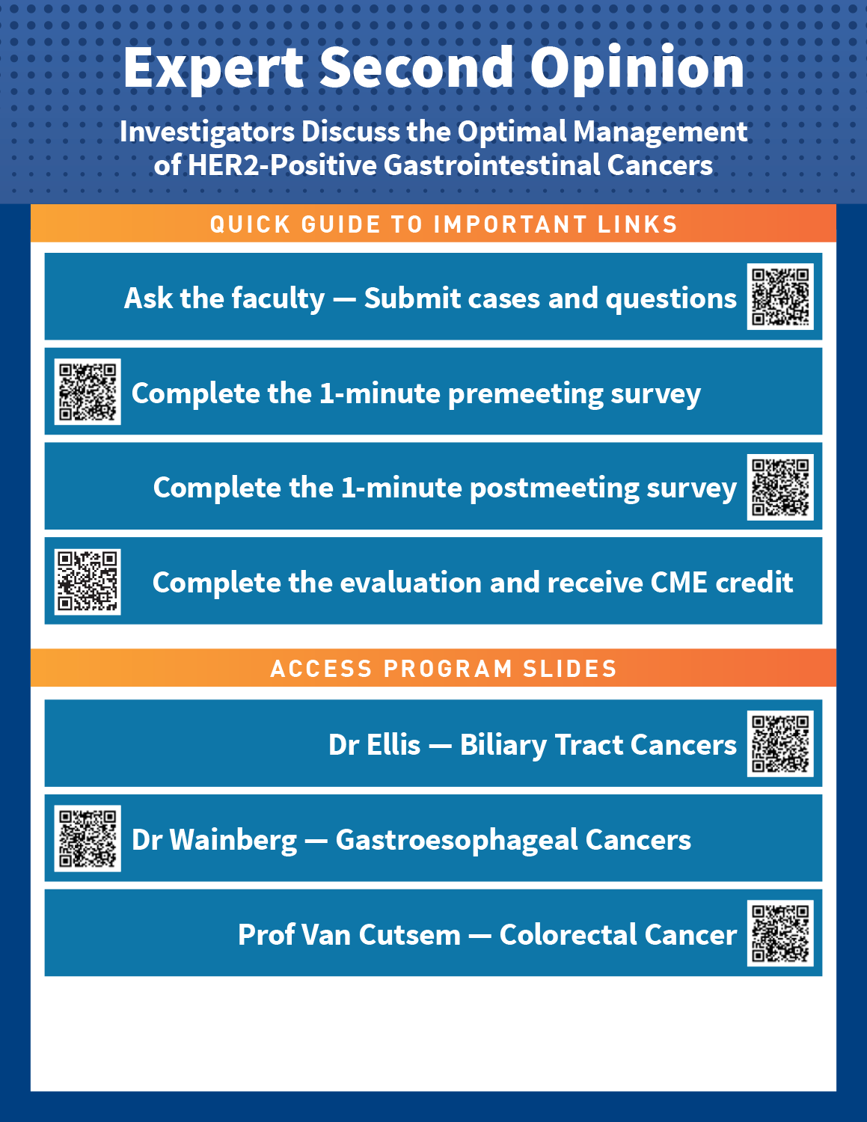




Clinicians in the Meeting Room
Please refer to the printed handout provided with your meeting syllabus, and scan the corresponding QR code to
Review and Download Program Slides.
Answer Survey Questions: Complete the pre-
and postmeeting surveys.
Ask a Question: We will aim to address as many questions as possible during the program.
Get CME Credit: Complete the course evaluation.
Notes:
11

Slide 12
Clinicians Attending via Zoom
Review Program Slides: A link to the program slides will be posted in the chat room at the start of the program.
Answer Survey Questions: Complete the pre- and postmeeting surveys.
Ask a Question: Submit a challenging case or question for discussion using the Zoom chat room.
Get CME Credit: A credit link will be provided in the chat room at the conclusion of the program.
Notes:
12

Slide 13
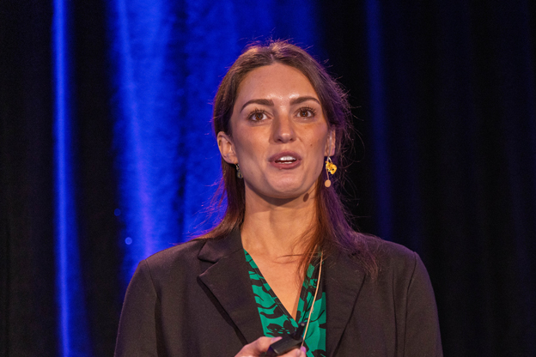
About the Enduring Program
The live meeting is being video
and audio recorded.
The proceedings from today will
be edited and developed into
an enduring web-based
program.
An email will be sent to all attendees when the activity is available.
To learn more about our education programs, visit our website, www.ResearchToPractice.com
Notes:
13

Slide 14
Expert Second Opinion:
Investigators Discuss the Optimal Management of HER2-Positive Gastrointestinal Cancers
A CME Symposium Held Adjunct to the 2026 ASCO® Gastrointestinal Cancers Symposium
Thursday, January 8, 2026
7:15 PM – 8:45 PM PT
Faculty
Haley Ellis, MD
Eric Van Cutsem, MD, PhD
Zev Wainberg, MD, MSc
Moderator
Lionel A Kankeu Fonkoua, MD

Slide 15
Agenda
Module 1: Biliary Tract Cancers — Dr Ellis
Module 2: Gastroesophageal Cancers — Dr Wainberg
Module 3: Colorectal Cancer — Prof Van Cutsem

Slide 16
Survey of 50 Community-Based
General Medical Oncologists
December 22, 2025 – January 7, 2026

Slide 17
Agenda
Module 1: Biliary Tract Cancers — Dr Ellis
Module 2: Gastroesophageal Cancers — Dr Wainberg
Module 3: Colorectal Cancer — Prof Van Cutsem

Slide 18
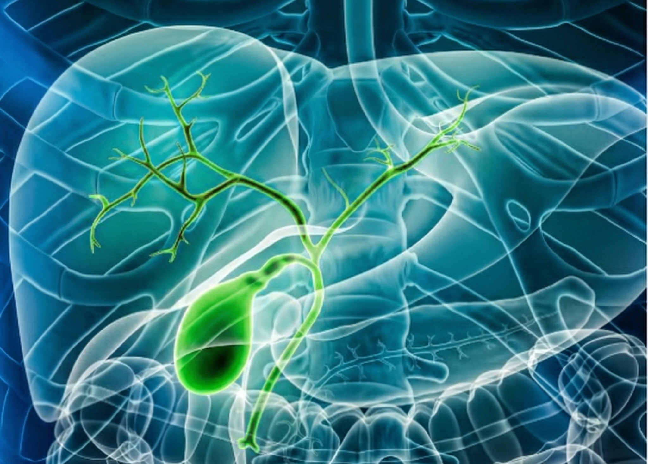
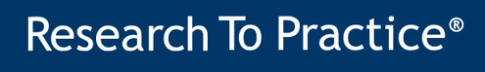


HER2-Positive
Biliary Tract Cancers
Dr. Haley Ellis
Mass General Brigham Cancer Institute, Attending Physician | Harvard Medical School, Instructor of Medicine
Tucker Gosnell Center for GI Cancers | Termeer Center for Targeted Therapies & Investigational Cancer Therapeutics

Slide 19



Overview
Biliary tract cancer (BTC) therapeutic landscape and prevalence of HER2
Clinical indications and methods for HER2 testing
Efficacy and safety of HER2-targeted therapies in BTC
  Trastuzumab deruxtecan (DESTINY-PanTumor02 and HERB trials)
  Zanidatamab (HERIZON-BTC-01 trial)
  Ongoing phase 3 trials for treatment-naïve patients
@DrHaleyEllis

Slide 20
Overview
Biliary tract cancer (BTC) therapeutic landscape and prevalence of HER2
Clinical indications and methods for HER2 testing
Efficacy and safety of HER2-targeted therapies in BTC
  Trastuzumab deruxtecan (DESTINY-PanTumor02 and HERB trials)
  Zanidatamab (HERIZON-BTC-01 trial)
  Ongoing phase 3 trials for treatment-naïve patients
@DrHaleyEllis

Slide 21
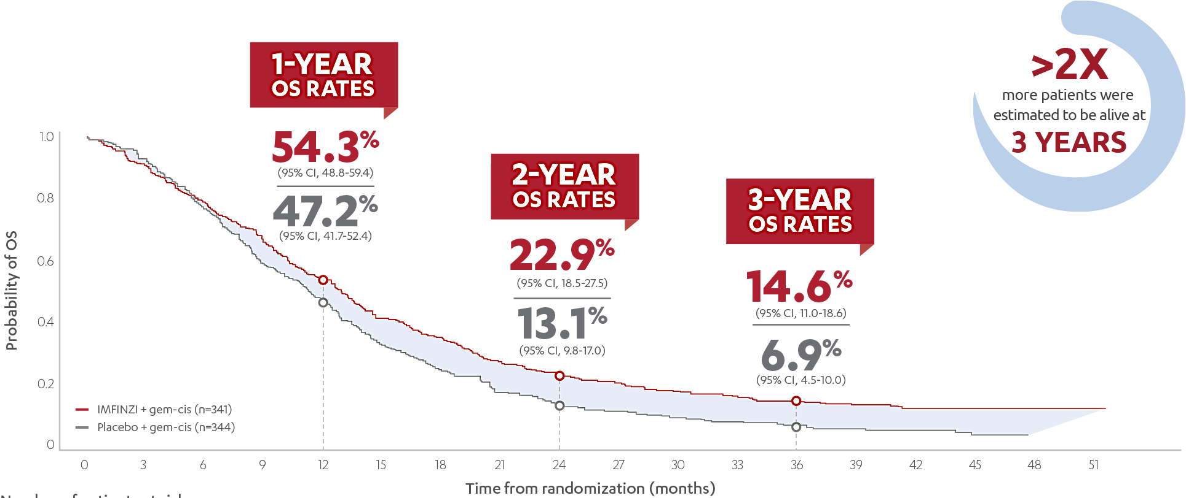
Chemotherapy plus immunotherapy is the
first-line standard in advanced BTC
Durvalumab + gem-cis (n=341)
TOPAZ-1: Oh et al. NEJM Evid 2022 | Oh et al. J Hepatol 2025
@DrHaleyEllis

Slide 22
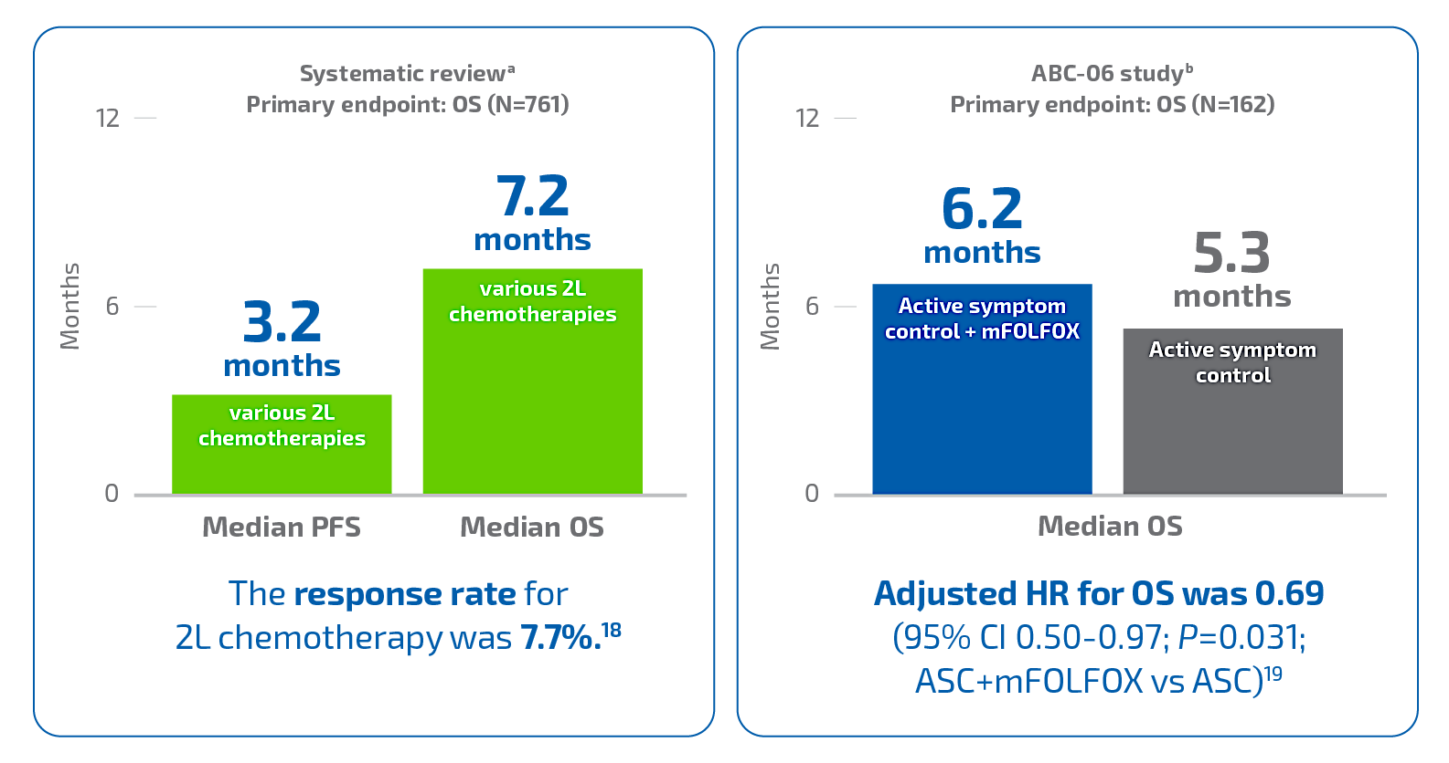
Limited benefit with second-line chemotherapy in BTC
Lamarca et al. Ann Oncol 2014 | ABC-06: Lamarca et al. Lancet Oncol 2021
@DrHaleyEllis

Slide 23
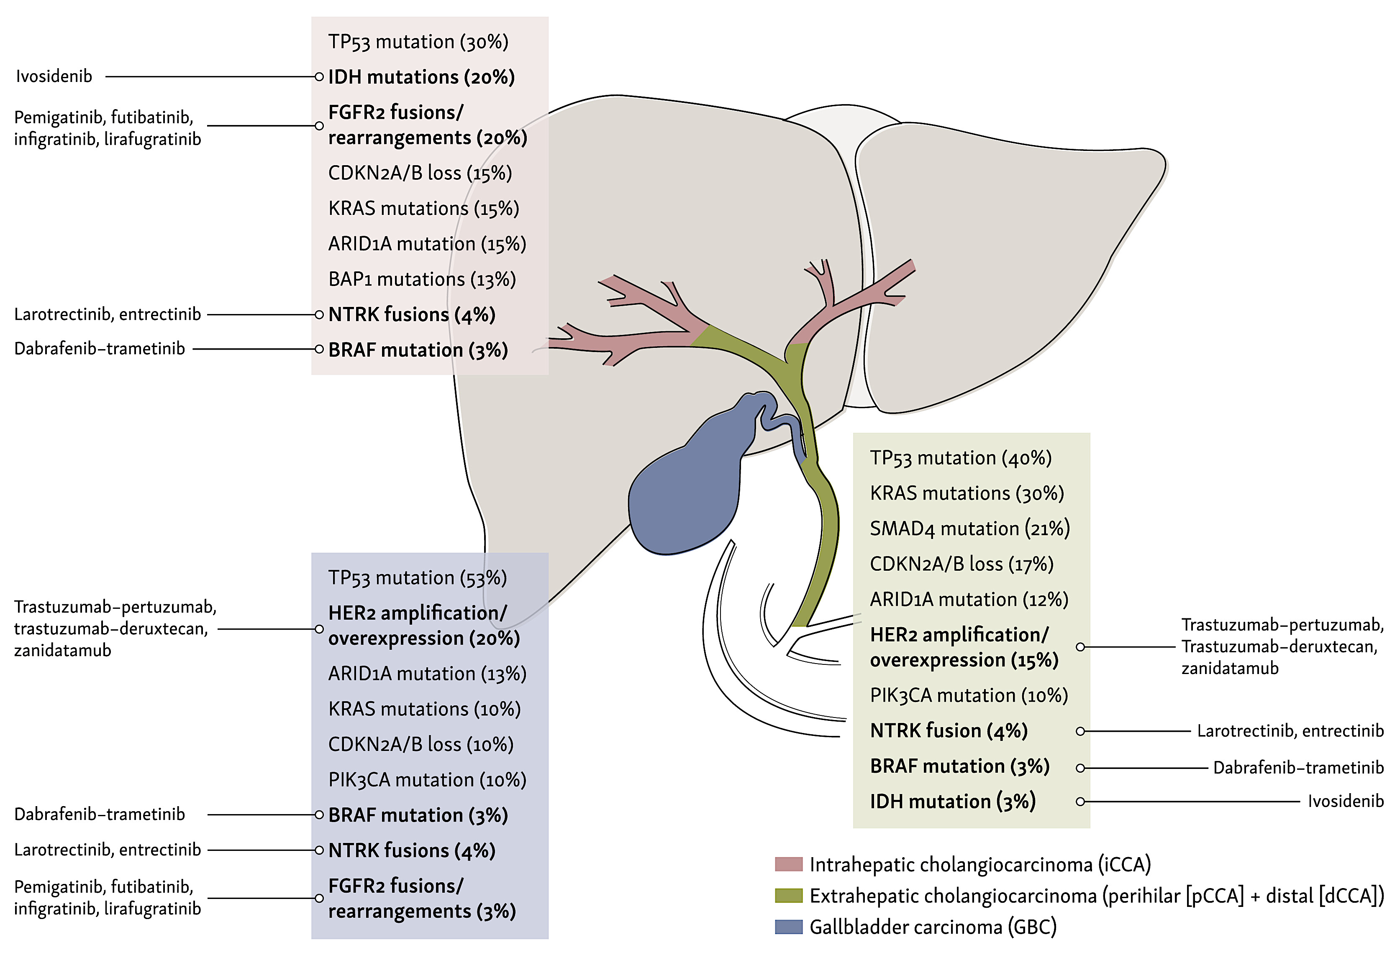
BTC has multiple actionable genomic targets
zanidatamab
zanidatamab
Kehmann et al. ESMO Open 2024
@DrHaleyEllis

Slide 24
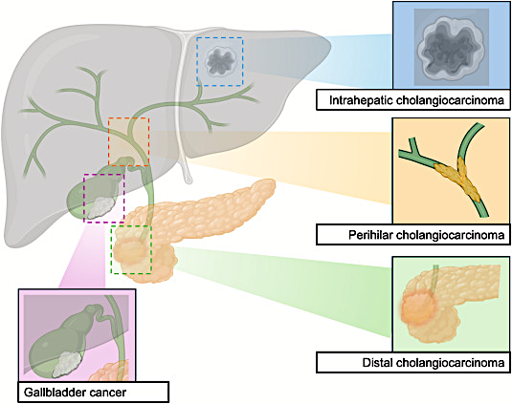
HER2 amplification/overexpression spans BTC subtypes
Intrahepatic cholangiocarcinoma (iCCA)
~3-5%
Extrahepatic cholangiocarcinoma (eCCA)
~10-20%
Gallbladder
cancer
(GBC)
~15-35%
Galdy et al. Cancer Metastasis Rev 2017 | Ayasun et al. Cancers 2023 | Soreide et al. Eur J Surg Oncol 2025
@DrHaleyEllis

Slide 25
Overview
Biliary tract cancer (BTC) therapeutic landscape and prevalence of HER2
Clinical indications and methods for HER2 testing
Efficacy and safety of HER2-targeted therapies in BTC
  Trastuzumab deruxtecan (DESTINY-PanTumor02 and HERB trials)
  Zanidatamab (HERIZON-BTC-01 trial)
  Ongoing phase 3 trials for treatment-naïve patients
@DrHaleyEllis

Slide 26
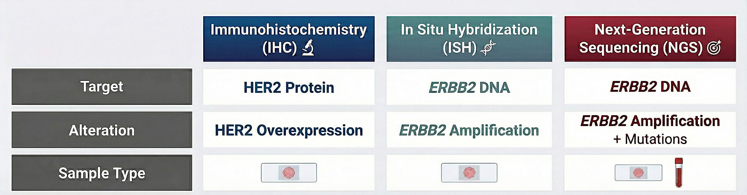
HER2 testing in BTC: who, when, and how
WHO: All patients with unresectable or metastatic BTC, across subtypes
WHEN: At diagnosis and/or repeat at progression
HOW:
Javle et al. Cancer 2016 | Jacobi et al. Oncol Res Treat 2021 | Inoue et al. JCO Precis Oncol 2025 | NCCN Guidelines 2025
@DrHaleyEllis

Slide 27
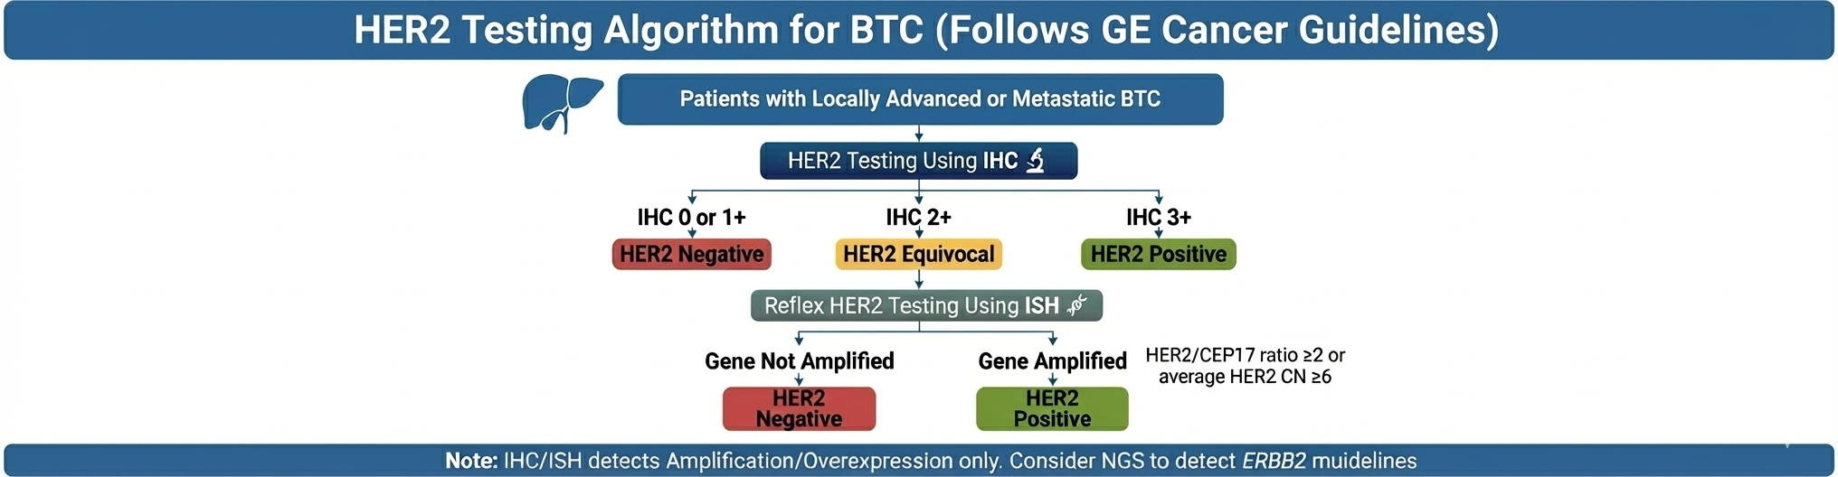
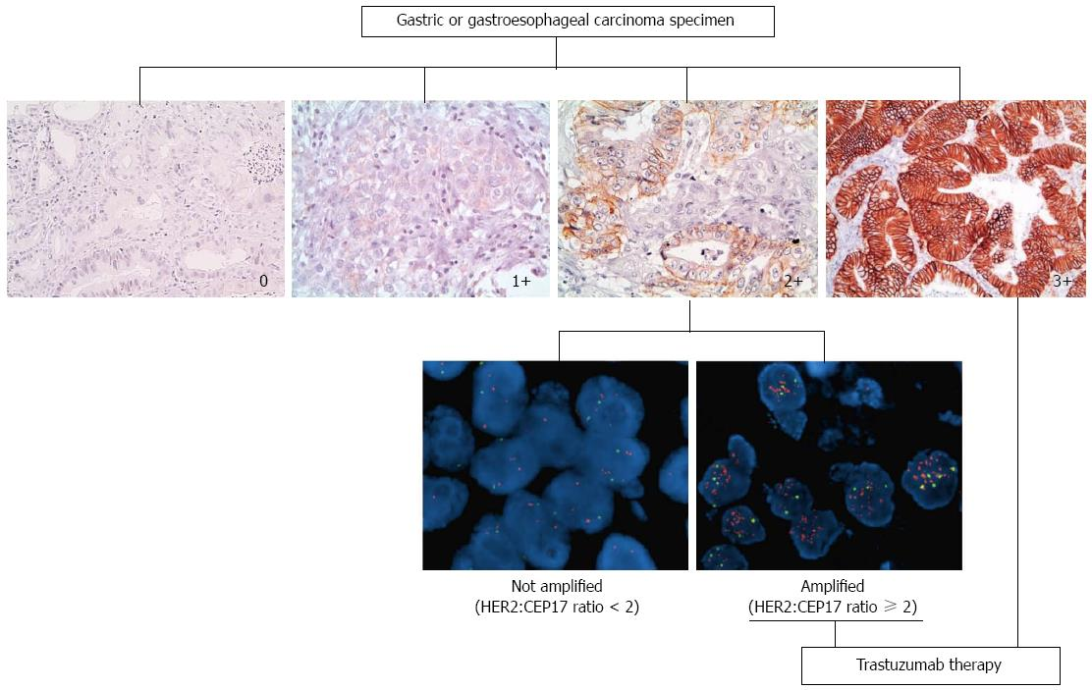
Defining HER2 positivity in BTC using gastric cancer scoring
Grillo et al. World J Gastroenterol 2016 | Bartley et al. J Clin Oncol 2017 | NCCN Guidelines 2025
@DrHaleyEllis

Slide 28
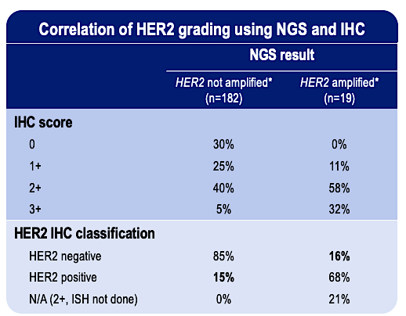
HER2 testing in BTC: use both IHC and NGS
~15% discordance between IHC and NGS in BTC
Lee et al. ASCO GI 2025
@DrHaleyEllis

Slide 29
Overview
Biliary tract cancer (BTC) therapeutic landscape and prevalence of HER2
Clinical indications and methods for HER2 testing
Efficacy and safety of HER2-targeted therapies in BTC
  Trastuzumab deruxtecan (DESTINY-PanTumor02 and HERB trials)
  Zanidatamab (HERIZON-BTC-01 trial)
  Ongoing phase 3 trials for treatment-naïve patients
@DrHaleyEllis

Slide 30
Second-line HER2-targeted therapy landscape in BTC
Trial | Treatment | Design | # BTC Pts | Prior HER2 Tx | HER2 Status | ORR | DCR | mDOR (mo) | mPFS (mo) | mOS (mo)
ABC-06¹ 2021 | FOLFOX | Phase 3 UK | 162 | -- | -- | 5% | 33% | -- | 4.0 | 6.2
MyPathway² 2021 | Trastuzumab + Pertuzumab | Phase 2 Basket, US | 39 | No | IHC 3+, ISH+, or NGS Amp | 23% | 51% | 10.8 | 4.0 | 10.9
KCSG-HB19-14³ 2023 | Trastuzumab + FOLFOX | Phase 2 Korea | 34 | No | IHC 3+ (68%), IHC 2+/ISH+ (32%), or NGS Amp | 29% | 79% | 4.9 | 5.1 | 10.7
SGNTUC-019⁴ 2023 | Trastuzumab + Tucatinib | Phase 2 Basket | 30 | No | IHC 3+, ISH+, or NGS Amp | 47% | 77% | 6.0 | 5.5 | 15.5
HERIZON- BTC-01⁵ 2023 | Zanidatamab | Phase 2 Global | 62 80 18 | No | IHC 3+ IHC 3+ or IHC 2+/ISH+ IHC 2+/ISH+ | 52% 41% 6% | 79% 69% 33% | 14.9 14.9 NE | 7.2 5.5 1.7 | 18.1 15.5 5.2
DESTINY-PanTumor02⁶ 2024 | Trastuzumab Deruxtecan | Phase 2 Basket, Global | 16 41 14 | Yes (17%) | IHC 3+ IHC 3+ or 2+ IHC 2+ | 56% 22% 0% | -- 78% -- | -- 8.6 -- | 7.4 4.6 4.2 | 12.4 7.0 6.0
HERB⁷ 2024 | Trastuzumab Deruxtecan | Phase 2 Japan | 22 8 | Yes (n = 0) | IHC 3+ IHC 3+ or IHC 2+/ISH+ IHC 2+/ISH-, IHC 1+/ISH-, IHC 0/ISH+ | 40% 36% 13% | -- 82% 75% | -- 7.4 -- | -- 5.1 3.5 | -- 7.1 8.9
SUMMIT⁸ 2023 | Neratinib | Phase 2 Basket | 25 | No | HER2 mutant | 16% | 28% | 3.7 | 2.8 | 5.4
¹Lamarca et al. Lancet Oncol 2021 | ²Javle et al. Lancet Oncol 2021 | ³Lee et al. Lancet Gastroenterol Hepatol 2023 | ⁴Nakamura et al. J Clin Oncol 2023 |
⁵Harding, Fan et al. Lancet Oncol 2023 | ⁶Meric-Bernstam et al. J Clin Oncol 2024 | ⁷Ohba et al. J Clin Oncol 2024 | ⁸Harding et al. Nat Comm 2023
@DrHaleyEllis

Slide 31
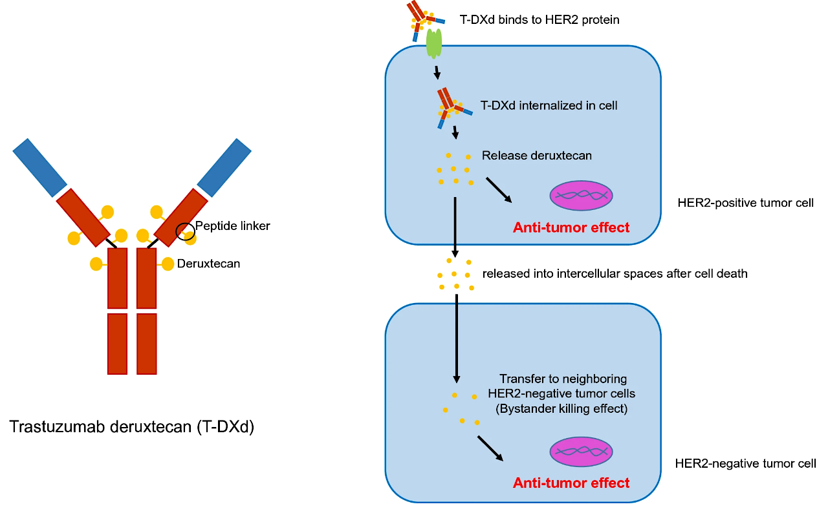
Trastuzumab deruxtecan (T-DXd): HER2 antibody-drug conjugate
FDA approved for previously treated, unresectable or metastatic HER2 IHC 3+ solid tumors
Aoki et al. Gastric Cancer 2021 | Ogitani et al. Cancer Sci 2016 | Ogitani et al. Clin Cancer Res 2016 | Nakada et al. Chem Pharm Bull (Tokyo) 2019 | Trastuzumab deruxtecan package insert
@DrHaleyEllis

Slide 32
DESTINY-PanTumor02 trial of T-DXd: eligibility and baseline
Locally advanced, unresectable, or metastatic HER2-expressing BTC, including AOV
Progressed after ≥ 1 systemic therapy or without alternative treatment options, including HER2 therapy
HER2 IHC 3+ or 2+ by central (17%) or local (83%) testing
Prior Lines of Therapy (Median 2)
37%
34%
22%
5%
2%
1
2
3
4
5+
Prior HER2 Therapy (17%)
Trastuzumab (n = 6)
Pertuzumab (n = 1)
Zanidatamab (n = 1)
Meric-Bernstam et al. J Clin Oncol 2024
@DrHaleyEllis

Slide 33
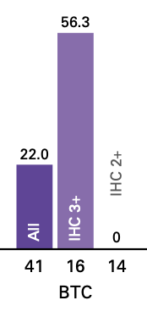
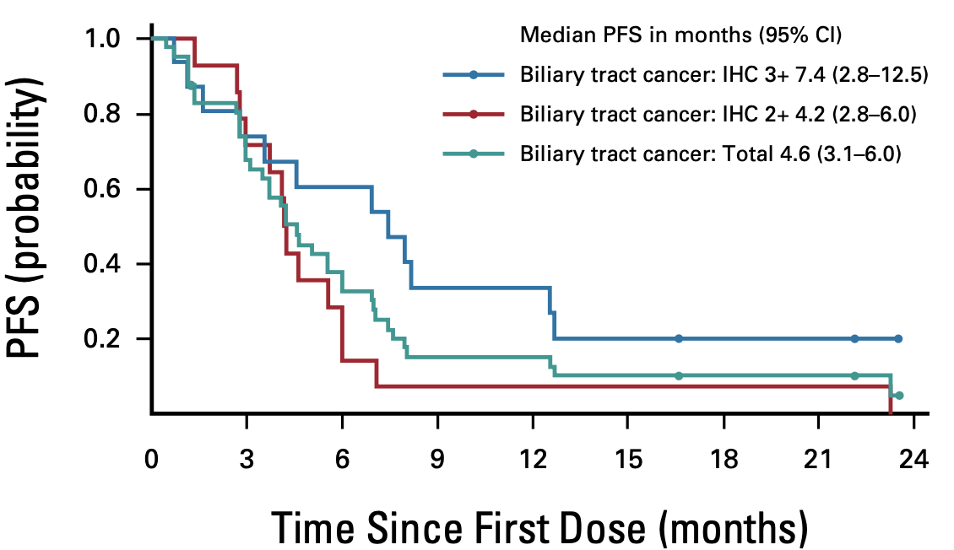
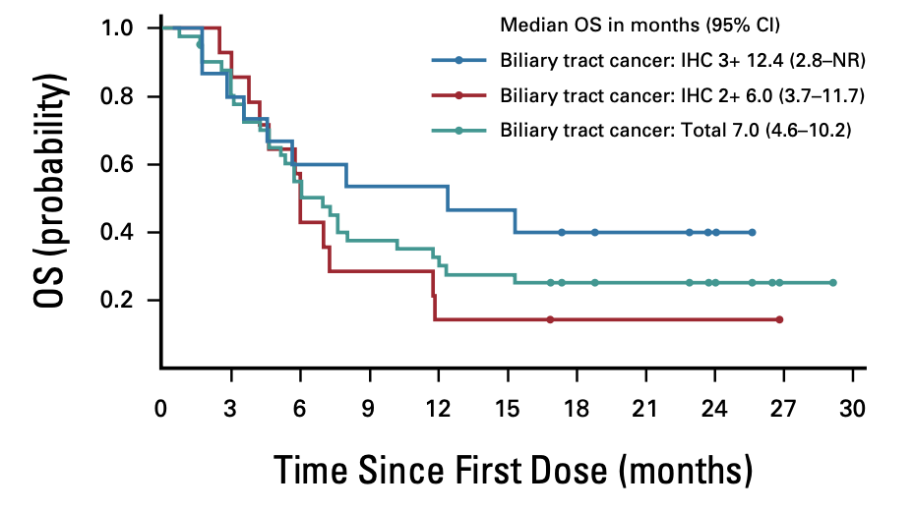
DESTINY-PanTumor02 trial of T-DXd: efficacy
Design | # BTC Pts | Prior HER2 Tx | HER2 Status | ORR | DCR | mDOR (mo) | mPFS (mo) | mOS (mo)
Phase 2 Basket, Global | 16 41 14 | Yes (17%) | IHC 3+ IHC 3+ or 2+ IHC 2+ | 56% 22% 0% | -- 78% -- | -- 8.6 -- | 7.4 4.6 4.2 | 12.4 7.0 6.0
IHC 3+ Outcomes
ORR: 56%
mPFS: 7.4 months
mOS: 12.4 months
Meric-Bernstam et al. J Clin Oncol 2024
@DrHaleyEllis

Slide 34


DESTINY-PanTumor02 trial of T-DXd: safety
Treatment-Related Adverse Events (TRAEs)
  39% Grade 3+
  12% Discontinued
  32% Dose reduced
Common TRAEs
  Nausea (46%), Vomiting (22%), Diarrhea (20%)
  Anemia (24%), Neutropenia (22%), Fatigue (22%)
ILD/Pneumonitis (11%) – across 267 patients in 7 cancer cohorts
  9.0% Grade 1-2
  0.4% Grade 3
  1.1% Grade 5 (1/3 patients with BTC)
Meric-Bernstam et al. J Clin Oncol 2024
@DrHaleyEllis

Slide 35
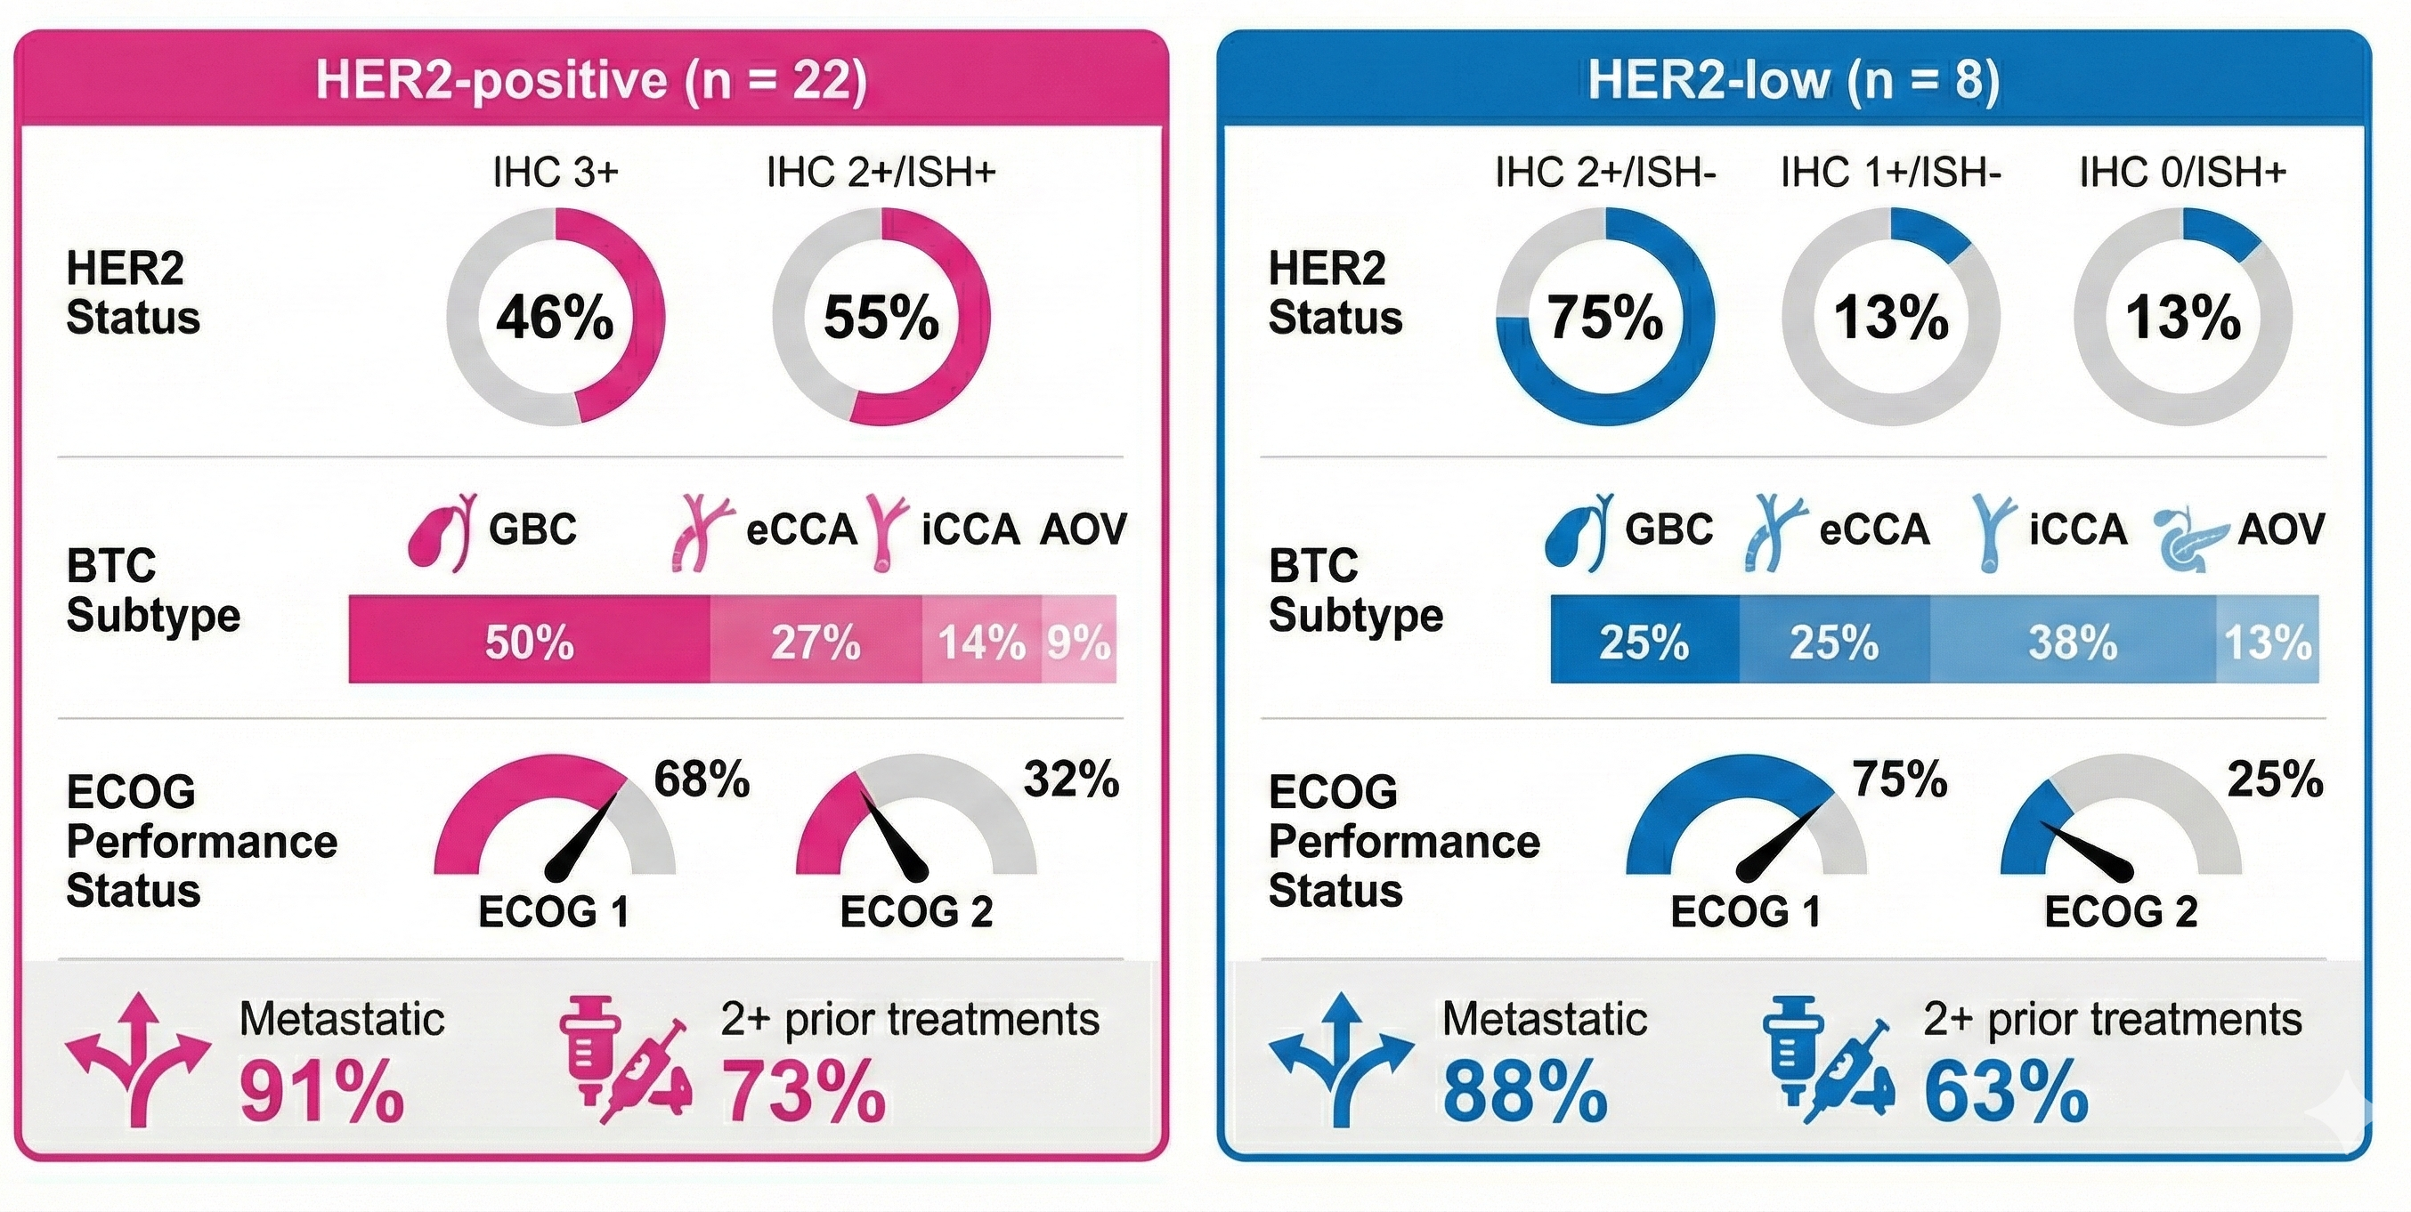
HERB trial of T-DXd: eligibility and baseline characteristics
Unresectable or recurrent HER2-expressing BTC
Refractory or intolerant to gemcitabine-containing regimen
  Prior HER2 therapy (n = 0)
HER2 status centrally confirmed
Ohba et al. J Clin Oncol 2024
@DrHaleyEllis

Slide 36
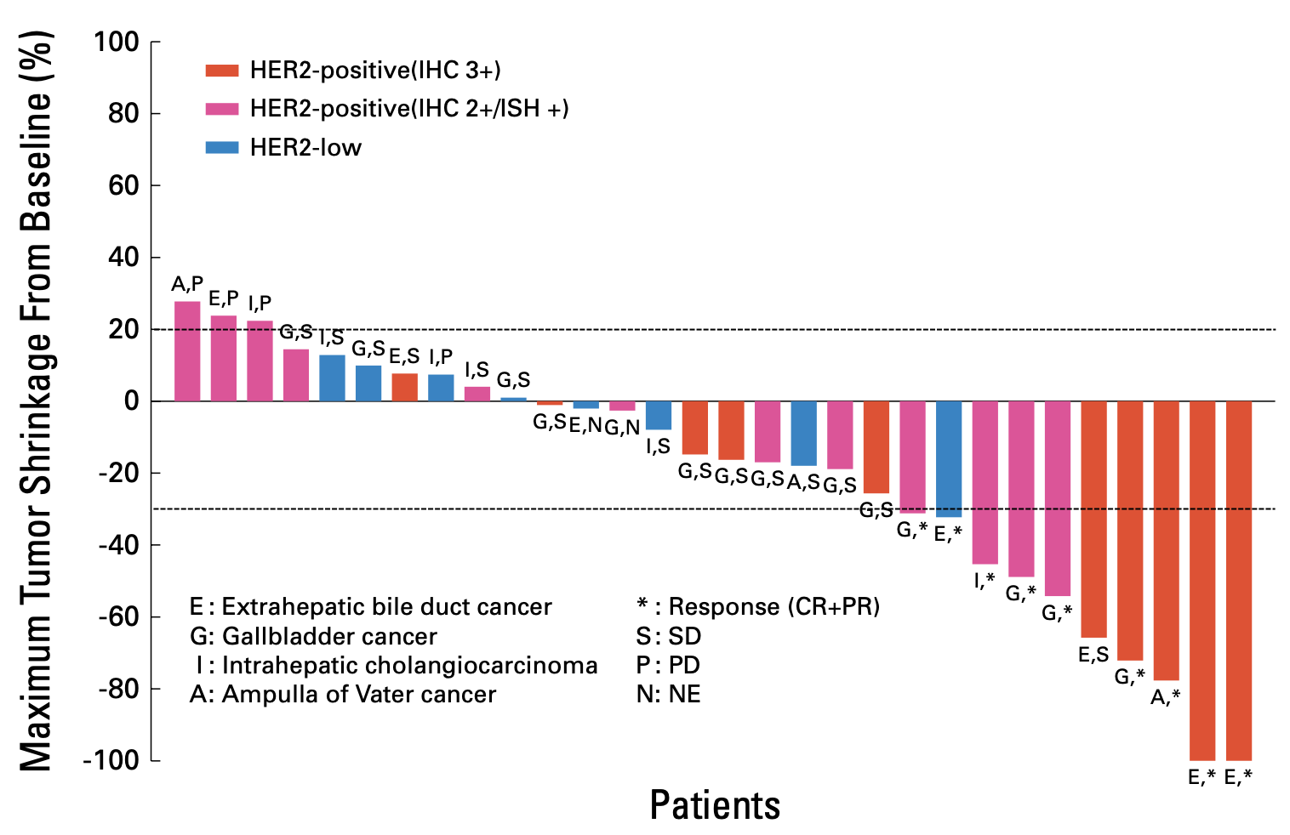
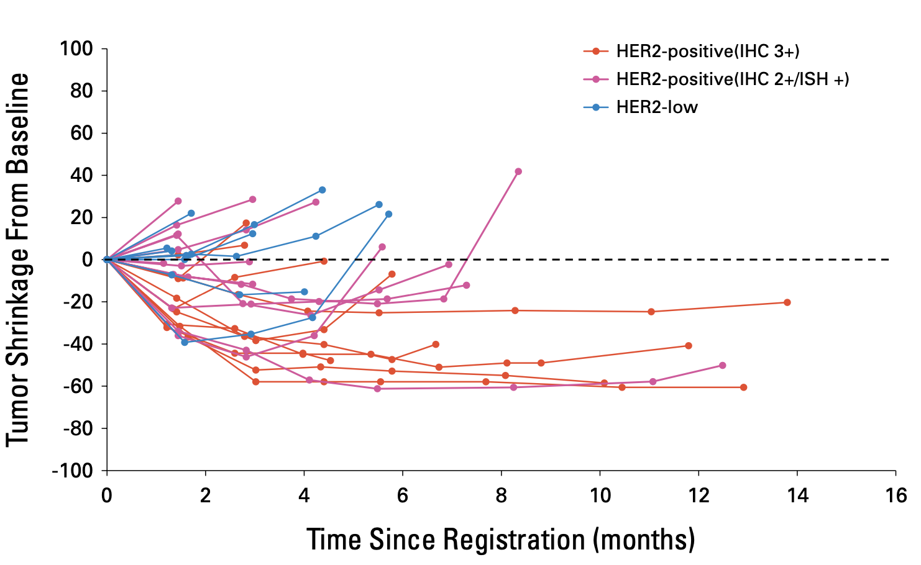
HERB trial of T-DXd: efficacy
Design | # BTC Pts | Prior HER2 Tx | HER2 Status | ORR | DCR | mDOR (mo) | mPFS (mo) | mOS (mo)
Phase 2 Japan | 22 10 12 8 6 1 1 | Yes (n = 0) | HER2 positive IHC 3+/ISH+ IHC 2+/ISH+ HER2 low IHC 2+/ISH- IHC 1+/ISH- IHC 0/ISH+ | 36% 40% 33% 13% | 82% 75% | 7.4 -- | 5.1 3.5 | 7.1 8.9
Ohba et al. J Clin Oncol 2024
@DrHaleyEllis

Slide 37
HERB trial of T-DXd: safety
Treatment-Related Adverse Events (TRAEs)
  82% Grade 3+
  25% Discontinued
  19% Dose reduced
Common Grade 3+ TRAEs
  Anemia (53%), Neutropenia (31%), Leukopenia (31%), Lymphopenia (22%)
ILD/Pneumonitis (25%)
  13% Grade 3+
  6% Grade 5 (1/3 patients with BTC)
Ohba et al. J Clin Oncol 2024
@DrHaleyEllis

Slide 38
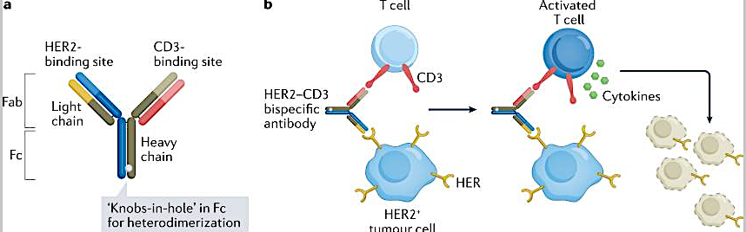
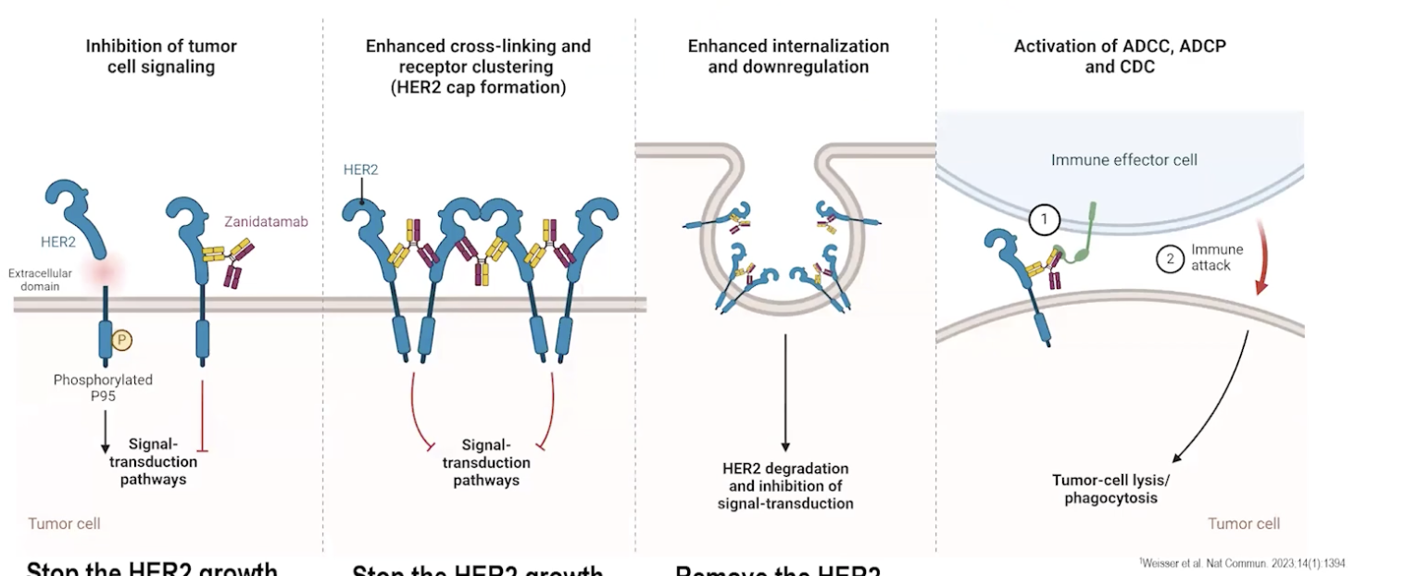
Zanidatamab: HER2 bispecific antibody
Simultaneously binds 2 distinct sites on HER2, facilitating unique mechanisms of action:
  Enhanced cross-linking and receptor clustering
  Increased receptor internalization and downregulation
  Inhibition of downstream signaling pathways
  Activation of ADCC, ADCP, CDC
FDA approved for previously treated, unresectable or metastatic HER2 IHC 3+ BTC
Swain et al. Nat Rev Drug Discov. 2022; Tabernero et al. Future Oncology 2022
@DrHaleyEllis

Slide 39
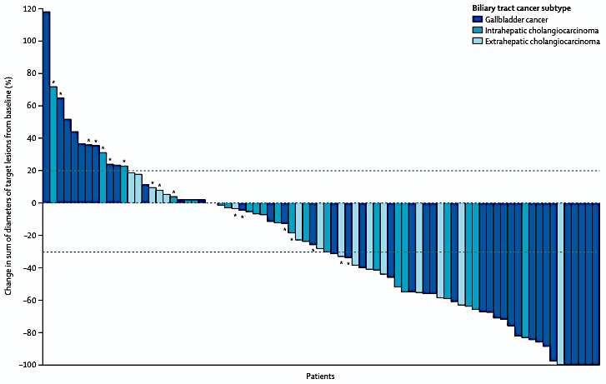
HERIZON-BTC-01 trial of zanidatamab: efficacy
Design | # BTC Pts | Prior HER2 Tx | HER2 Status | ORR | DCR | mDOR (mo) | mPFS (mo) | mOS (mo)
Phase 2b Global | 62 80 18 | No | IHC 3+ IHC 3+ or IHC 2+/ISH+ IHC 2+/ISH+ | 52% 41% 6% | 79% 69% 33% | 14.9 14.9 NE | 7.2 5.5 1.7 | 18.1 15.5 5.2
Previously treated unresectable, locally advanced, or metastatic BTC
HER2 amplification confirmed by ISH per central testing
51% GBC, 29% iCCA, 20% eCCA
Harding, Fan et al. Lancet Oncol 2023 | Pant et al. JAMA Oncol 2025
@DrHaleyEllis

Slide 40
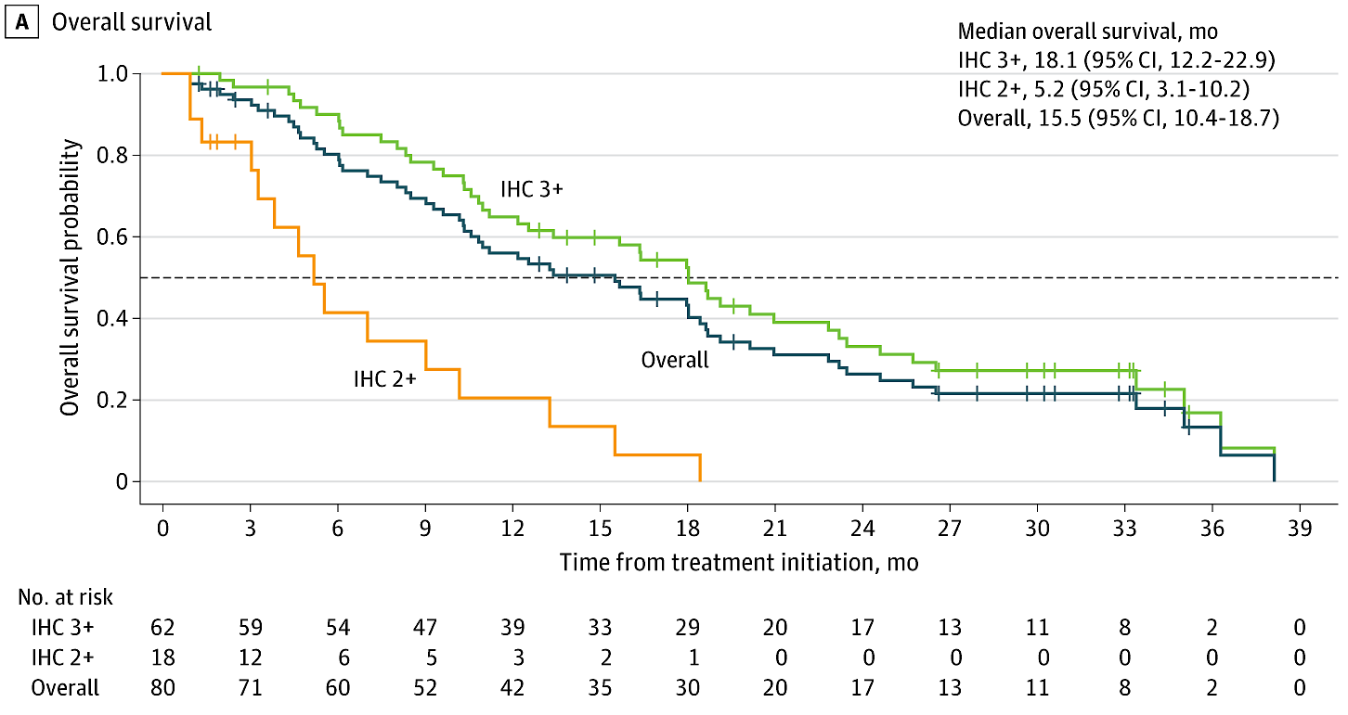
HERIZON-BTC-01 trial of zanidatamab: long-term follow-up
33-month follow-up
Pant et al. JAMA Oncol 2025
@DrHaleyEllis

Slide 41
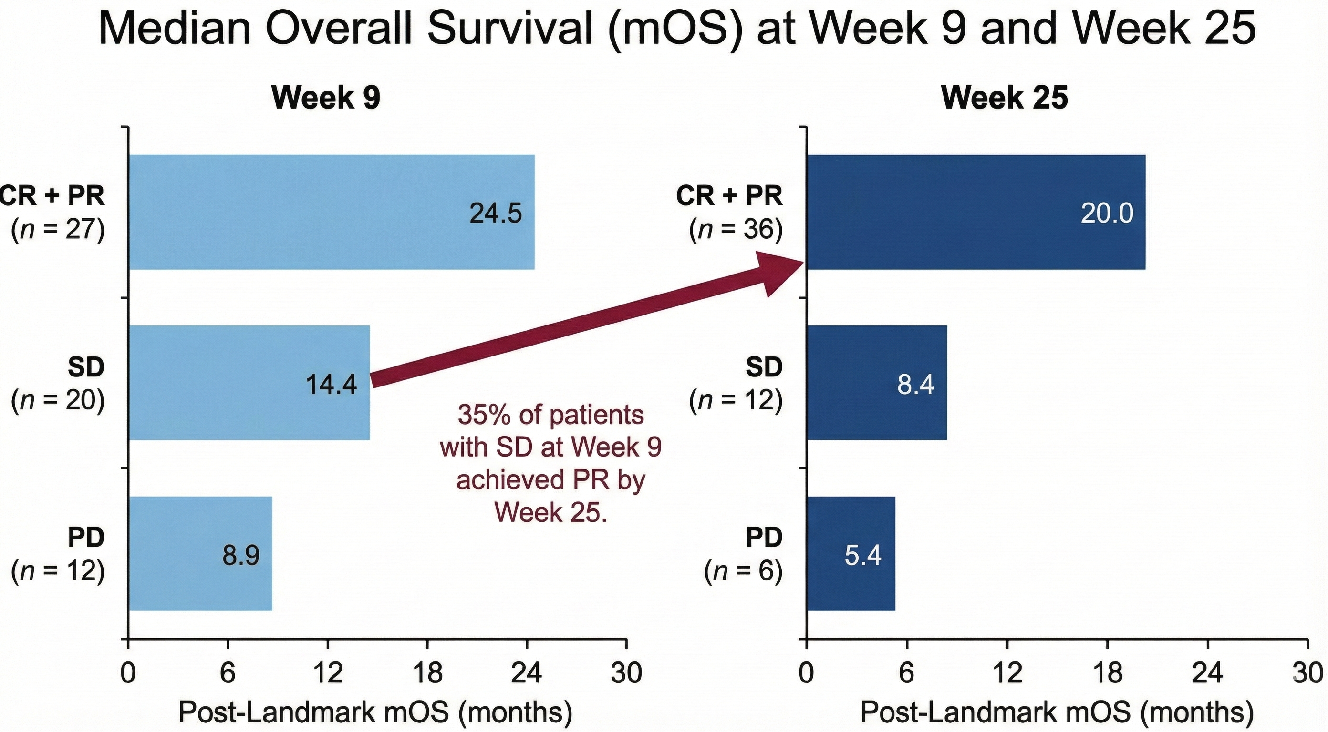
HERIZON-BTC-01 trial of zanidatamab: post hoc analysis
HER2 IHC 3+ patients (n = 62)
Harding et al. ASCO GI 2026, Abstr 545
@DrHaleyEllis

Slide 42

HERIZON-BTC-01 trial of zanidatamab: safety
Diarrhea (50%) – mostly grade 1-2
  Supportive care with antidiarrheals and hydration
  Grade 1-2: resume at same dose or consider dose reduction
  Grade 3: hold until grade <1, then resume at reduced dose (15 mg/kg)
Infusion-related reactions (35%) – mostly grade 1-2
  Premedicate 30-60 min prior (acetaminophen, antihistamine, corticosteroid)
  Shorten infusion duration from 120-150 min to 60 min, if well-tolerated
  Permanent discontinuation (0.4%)
Left ventricular dysfunction (4%) → resolved (70%); permanent discontinuation (0.9%)
No cytokine release syndrome – not a T-cell engager
Harding, Fan et al. Lancet Oncol 2023; Zanidatamab package insert
@DrHaleyEllis

Slide 43
Ongoing phase 3 studies of HER2 therapies for
treatment-naïve HER2+ advanced BTC
 | DESTINY-BTC-01 NCT06467357 | HERIZON-BTC-302 NCT06282575
Trial Design | Global, randomized phase 3 trial | Global, randomized phase 3 trial
Target # Pts | 620 | 286
HER2 Status | IHC 3+ or IHC 2+ | IHC 3+ or IHC 2+/ISH+
Treatments | T-DXd + Rilvegostomig (PD-1/TIGIT bispecific) vs T-DXd vs Gem/Cis/Durva (SOC) | Gem/Cis +/- PD-(L)1 inhibitor + Zanidatamab vs Gem/Cis +/- PD-(L)1 inhibitor (SOC)
Prior Tx |  | May have received < 2 cycles of chemo +/- ICI
1º Endpoint | OS in IHC 3+ with T-DXd + Rilve vs SOC | PFS in IHC 3+
2º Endpoints | OS in IHC 3+/2+ T-DXd + Rilve vs SOC OS in IHC 3+ and 3+/2+ T-DXd vs SOC PFS in IHC 3+ and 3+/2+ T-DXd +/- Rilve vs SOC ORR, DOR Safety, tolerability | OS in IHC 3+ and overall population PFS in overall population ORR Adverse events PROs
Ikeda et al. ESMO 2024 | Harding et al. ASCO GI 2025
@DrHaleyEllis

Slide 44
Take Home Messages
📌 HER2 amplification/overexpression occurs across all BTC subtypes (~5-35%)
📌 Early, comprehensive HER2 testing using NGS and IHC recommended for all patients with locally advanced or metastatic BTC, when feasible
📌 HER2-targeted treatments are rapidly advancing in BTC
  T-DXd and Zanidatamab are approved and effective for previously treated HER2 IHC 3+ BTC
  Consider first-line trials in HER2-driven BTC
  Therapy sequencing should be individualized, taking into account comorbidities, side effect profile, mechanism of action, prior treatments, etc.
@DrHaleyEllis

Slide 45
Questions from General Medical Oncologists —
Biliary Tract Cancers
78-year-old woman with HER2-amplified BTC s/p gemcitabine + cisplatin + pembrolizumab now with PD in the liver and rising TBili = 3.7, unstentable. Approach to HER2-positive disease in the setting of elevated TBili?
72 yo F with HER2-positive metastatic biliary cancer, history of CHF with EF 40%. Role of T-DXd or zanidatamab in patients with reduced EF? How to manage the toxicity of zanidatamab?

Slide 46
Questions from General Medical Oncologists —
Biliary Tract Cancers
62 yo male with node-positive gallbladder cancer, HER2-positive. He was treated per BILCAP trial with capecitabine adjuvantly and a year later developed liver mets. He wants to be aggressive. Would you give trastuzumab deruxtecan or zanidatamab first line and skip cis/gem/durva since he has had “a previous chemotherapy”?
93 yr old female diagnosed with Stage IV gallbladder cancer with HER2 IHC 3+. Baseline ECOG 2 due to generalized frailty. Would you consider treating an elderly frail pt with anti-HER2 therapy in the front line, and if so, what would be your preferred treatment?

Slide 47
Questions from General Medical Oncologists —
Biliary Tract Cancers
70 yo man with advanced BTC post 1st-line chemoimmunotherapy. Progressing now, HER2-positive and FGFR fusion. How to choose between anti-HER2 and anti-FGFR therapy? Is there a better sequence?
81 yo with CKD and metastatic cholangiocarcinoma, NGS noted IDH2 mutation, HER2 IHC 2+. Disease progressed on durva/carbo/gem. Would you target HER2 or IDH2 in the 2nd line?

Slide 48
Questions from General Medical Oncologists —
Biliary Tract Cancers
61 yo male with HER2 IHC 3+ cholangiocarcinoma with h/o kidney transplantation 3 yrs prior. Would you plan to give anti-HER2 tx up front? In such a case, can I use either T-DXd or zanidatamab first to bypass using front-line gemicitabine + cisplatin chemo alone?
67 yo male with HER2 IHC 3+ cholangiocarcinoma treated with cis/gem/durva and developed Grade 2 pneumonitis on durva, which resolved quickly with steroids. Now has disease progression 11 months later. Would you give trastuzumab deruxtecan to this patient with previous pneumonitis, although completely and quickly resolved, on durva?

Slide 49
Agenda
Module 1: Biliary Tract Cancers — Dr Ellis
Module 2: Gastroesophageal Cancers — Dr Wainberg
Module 3: Colorectal Cancer — Prof Van Cutsem

Slide 50
HER 2+ Gastric/GEJ Cancers
Zev Wainberg, MD
Co-Director, UCLA Gastrointestinal Oncology Program
Director, Early Phase Clinical Research Program, Jonsson Comprehensive Cancer Center
Professor of Medicine and Surgery, David Geffen School of Medicine at UCLA

Slide 51
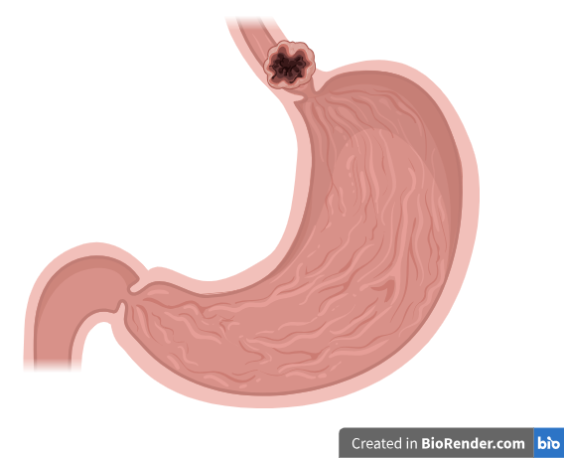
HER2 biology in gastroesophageal adenocarcinoma
~15-20% of gastric/ GE adenocarcinoma
Member of the HER family of receptors (HER1/EGFR, HER3, HER4)
HER2 heterodimerization activates downstream RAS/MAPK and PI3K signaling pathways
Intestinal type > diffuse type
Typical anatomical location: GE jxn/ esophagus
Associated with PDL1 co-expression and a favorable tumor immune microenvironment
HER2+ more
common
HER2+ less
common
Koopman et al., J Cancer Research and Clin Oncol 2021;39(Suppl 15):4045.
Yang et al., Lancet 2024;404(10466):1991-2005.
Bartley et al., J Clin Oncol 2017;35(4):446-464.

Slide 52
HER2 testing: IHC +/- FISH is the gold standard, but there are other options
Diagnostic test | Diagnostic Criteria for Positive Result | Advantages | Disadvantages
IHC +/- FISH* | IHC 3+ OR IHC 2+ and FISH+ | GOLD STANDARD Cost effective Rapid | Requires tissue Intra- and inter-lesional heterogeneity
Tissue NGS | copy number ≥5 with >80% of exons amplified ≥2.5-fold change in copy number | High concordance with IHC/FISH Multiple targets tested simultaneously | Cost Longer turn around time
Blood NGS | “Amplification” Variable copy number cutoffs | Speed Convenience Detects intra-and inter-lesional heterogeneity | Cost Requires high shedding Lower sensitivity
* Immunohistochemistry (IHC) score of 3+ (showing strong complete or basolateral membranous staining in > 10% of the tumor cells [surgical specimen] or in a tumor cell cluster [≥ 5 cells] irrespective of percentage of tumor cells stained [biopsy]) or IHC score of 2+ (moderate/weak complete basolateral or lateral membranous reactivity in > 10% of the neoplastic cells [surgical specimen] or in a tumor cluster [≥ 5 tumor cells {biopsy}]). Gene amplification by in situ hybridization (ISH+) (chromosome enumeration probe [CEP] 17 ratio ≥ 2 or average HER2 copy number ≥6 signals/cell.
Klempner et al., J Clin Oncol 2021;39(Suppl 15):4045.
Ross et al., J Mol Diagnostics 2017;19(2):244-254.
Bartley et al., J Clin Oncol 2017;35(4):446-464.

Slide 53
HER2-Targeting Agents as First-Line Treatment: Esophagogastric Cancer is Not Breast Cancer
Trastuzumab approved first line
  ToGA: Cape-Cis + trastuzumab improved RR, PFS, OS
  mOS in IHC2+/FISH or IHC3+ for trastuzumab + CT vs CT: 16.0 vs 11.8; HR (95% CI): 0.65 (0.51-0.83)
First-line lapatinib + cape/oxaliplatin
  No difference in OS
  mOs for lapatinib + cape/oxaliplatin vs cape/oxaliplatin: 12.2 vs 10.5 (HR: 0.91: 0.73-1.12; P = .3492)
First-line pertuzumab + trastuzumab/Cis+ FU
  No difference in OS
  mOS for pertuzumab vs control: 17.5 vs 14.2 mos (HR (95% CI): 0.84 (0.71-1.00), P = .057)
1.0
0.8
Trastuzumab plus chemotherapy
Chemotherapy only
0.6
Survival probability
0.4
0.2
0
11.8
16.0
0
2
4
6
8
36
10
12
14
16
18
20
22
24
26
28
30
32
34
Time (months)
1.0
0.8
CapeOx+L
CapeOx+P
0.6
Cumulative Survival
(probability)
0.4
0.2
0
0
5
10
15
20
25
30
35
40
45
Time from Random Assignment (months)
100
80
Pertuzumab group
Control group
60
Overall Survival (%)
40
20
0
0
2
4
6
8
10
12
14
16
18
20
22
24
26
28
30
32
34
36
38
40
42
Time since randomisation (months)
Bang. Lancet. 2010;376: 687. Hecht. JCO. 2016;34:443. Tabernero. Lancet Oncol. 2018;19: 1372.

Slide 54
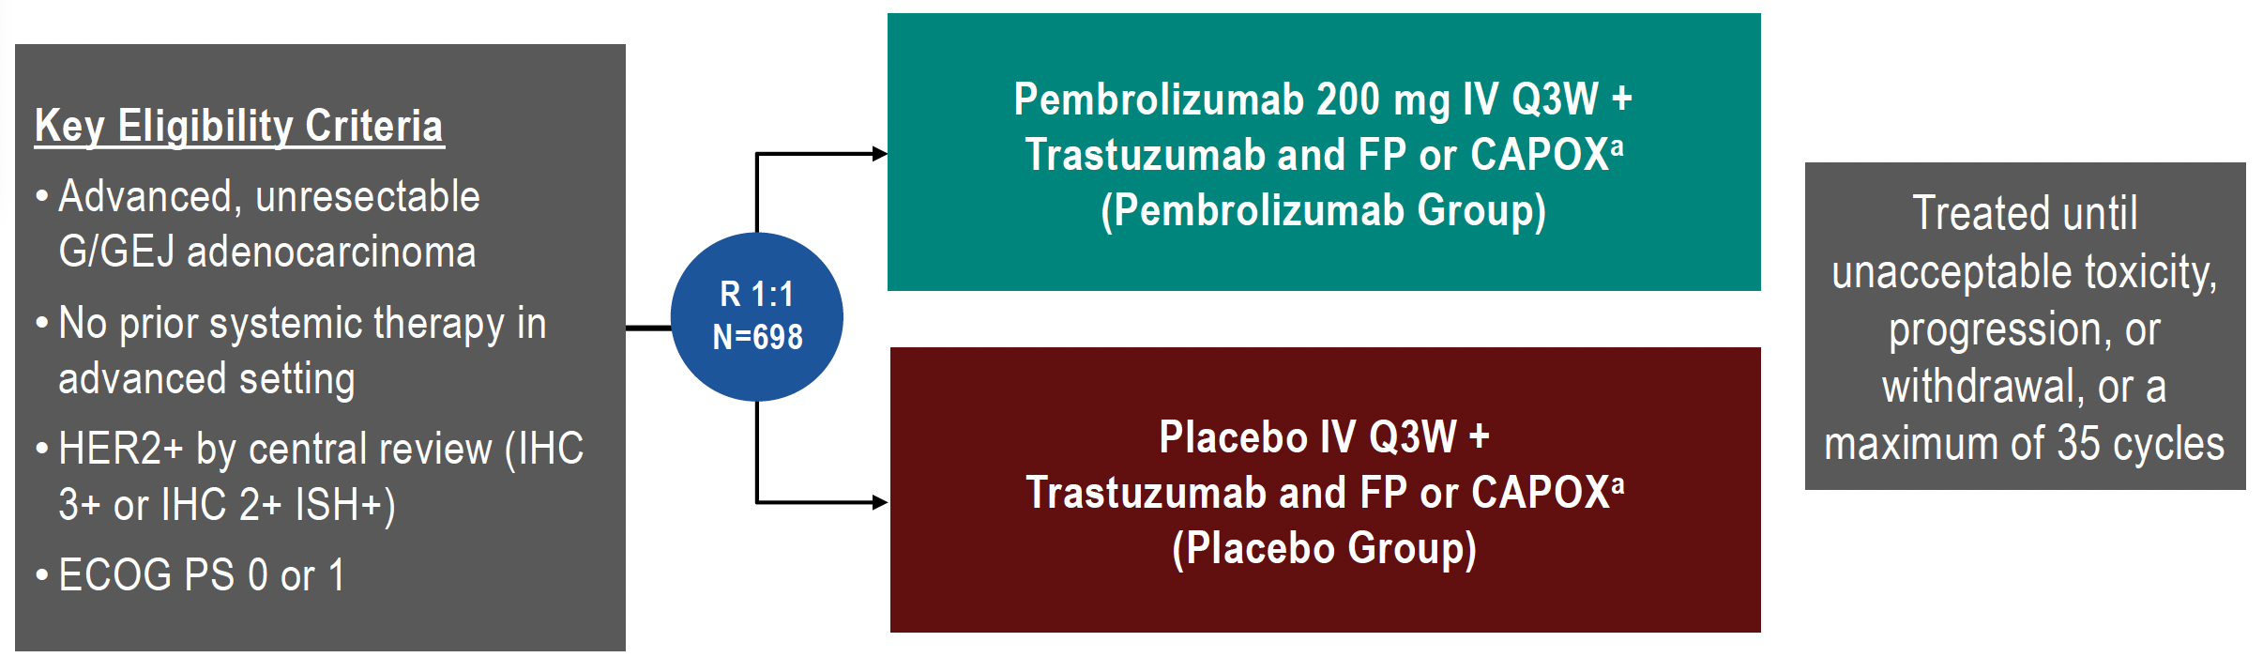
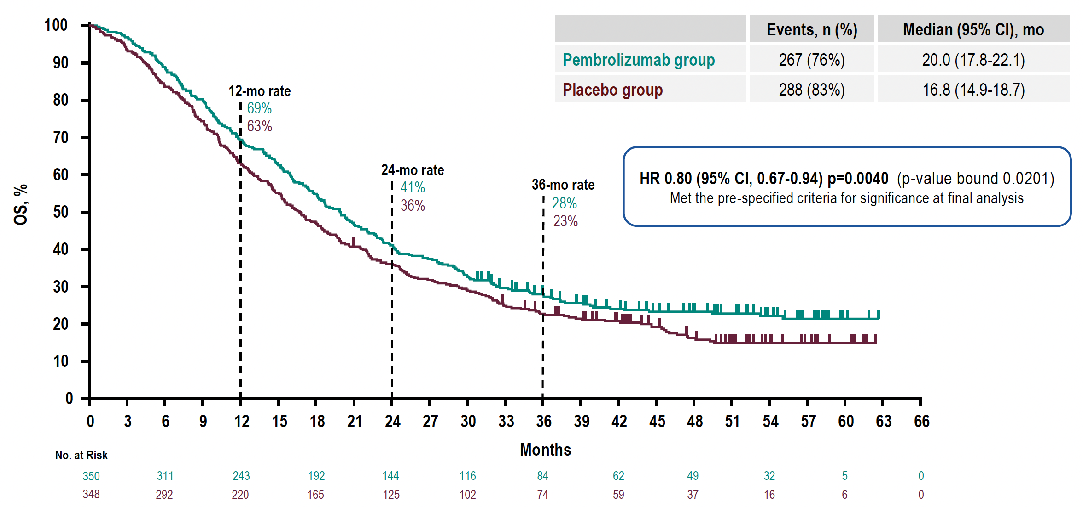
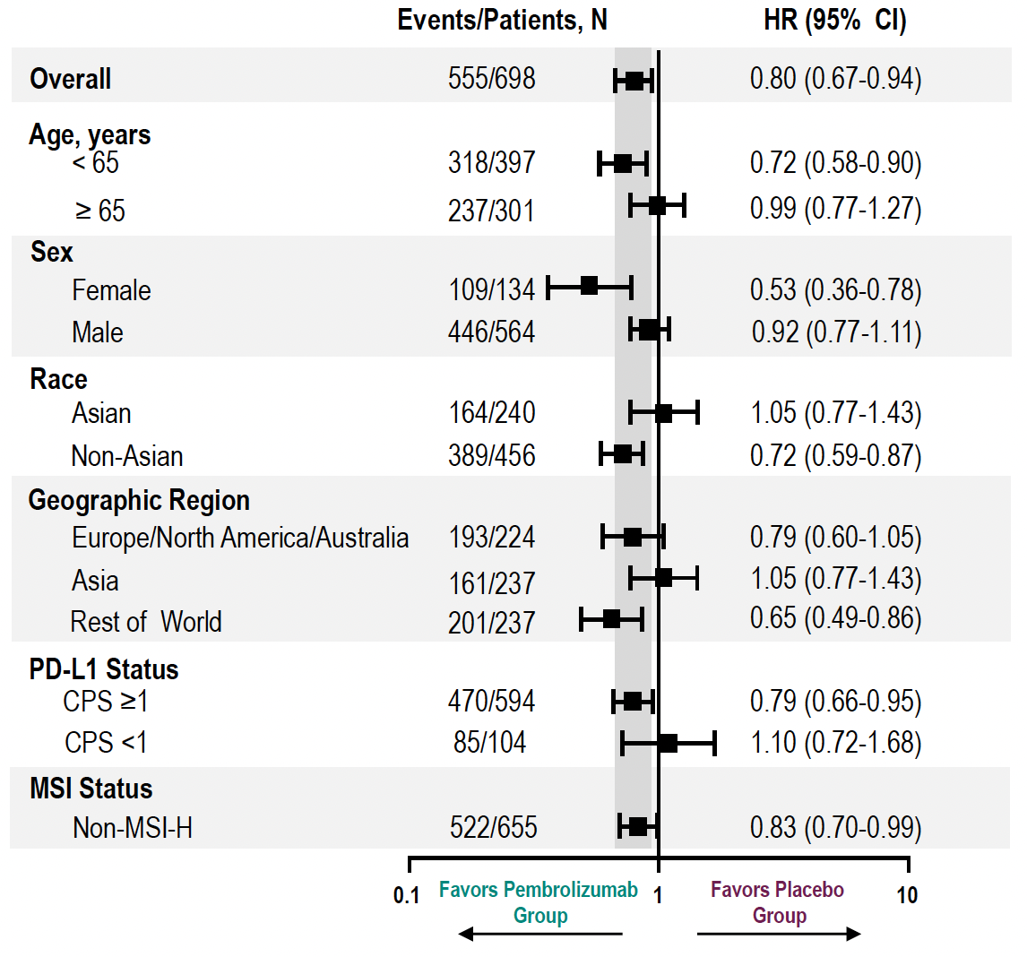
KEYNOTE-811: Final OS Analysis
Janjigian YY et al. ESMO 2024;Abstract 1400O.

Slide 55
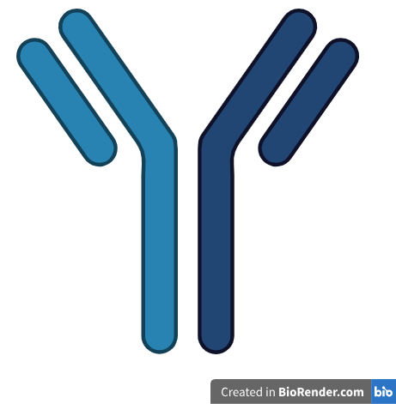
Emerging 1L option for HER2+ GEA: Zanidatamab
Phase 2, multi-center, open-label, two-part study
Enrolled patients with previous untreated metastatic/ advanced HER2+ GEA (HER2 IHC 3+ or 2+/FISH+)
Treatment with zanidatamab + chemotherapy (CAPOX, mFOLFOX6, or 5FU/cis)
Study
design
ORR= 76%, median DOR= 18.7 months (N= 42)
Median PFS= 12.5 months (N=46)
Median OS= 36.5 months
Key
outcomes
HER2-targeted, humanized, bispecific monoclonal antibody
Binds to the HER2 juxtamembrane domain (ECD4) and dimerization domain (ECD2)
FDA-approved for HER2+ BTC (IHC=3+, previously treated)
24/25 patients (96%) experienced diarrhea
Protocol amendment: Mandatory anti-diarrheal prophylaxis and omission of 5FU bolus (part 2)
Post-implementation ORR= 95%
Toxicity
management
Elimova et al., Lancet Oncol 2025; 26: 847-859.

Slide 56

HERIZON-GEA-01 Study Design
Global phase 3 trial of zanidatamab + chemotherapy ± tislelizumab vs trastuzumab + chemotherapy in previously untreated patients with HER2+ mGEA
Key Eligibility Criteria
Age ≥18 years
Unresectable, locally advanced, recurrent or metastatic GEA
HER2 IHC 3+ or IHC 2+/ISH+
per central testing
ECOG PS 0 or 1
No prior treatment for locally advanced or metastatic disease
No prior HER2-targeted agents or immunotherapy in any setting
Arm A: Trastuzumab +
chemotherapyª
Dual Primary Endpoints
PFS (per BICR)
OS
Select Secondary Endpoints
cORR (per BICR)
Frequency and severity of AEs
R 1:1:1
Arm B: Zanidatamab
1800 mg (<70 kg)/2400 mg (≥70 kg) IV Q3W
+ chemotherapyª
CT/MRI^{c} Q6W
Arm C: Zanidatamab
1800 mg (<70 kg)/2400 mg (≥70 kg) IV Q3W
+ tislelizumab^{b} + chemotherapyª
ClinicalTrials.gov: NCT05152147
Stratification Factors
Geographic region
HER2 status
ECOG PS
Prophylaxis to prevent IRR and diarrhea was
mandatory in the zanidatamab-containing arms
Treatment until disease progression/death/unacceptable toxicity
Chemotherapy could be discontinued after 6 cycles
ªPhysician’s choice of capecitabine plus oxaliplatin or 5-fluorouracil plus cisplatin. Chemotherapy was administered for at least 6 cycles or until disease progression, unacceptable toxicity, or another criterion for treatment discontinuation was met.
^{b}Tislelizumab 200 mg was administered IV Q3W. ^{c}CT/MRI scans were performed every 6 weeks for the first 54 weeks, then every 9 weeks.
AE, adverse event; BICR, blinded independent central review; cORR, confirmed objective response rate; CT, computed tomography; ECOG PS, Eastern Cooperative Oncology Group performance status; GEA, gastroesophageal adenocarcinoma;
HER2, human epidermal growth factor receptor 2; IHC, immunohistochemistry; IRR, infusion-related reaction; ISH, in situ hybridization; IV, intravenously; mGEA, advanced or metastatic GEA; MRI, magnetic resonance imaging; OS, overall survival;
PFS, progression-free survival; Q3W, every 3 weeks; Q6W, every 6 weeks; R, randomization.
Elena Elimova, MD

Slide 57
Patient Disposition
A total of 914 patients were randomized, and median follow-up was >2 years
Randomized
N = 914
Zanidatamab + CT
n = 304; 300 patients treatedª
Zanidatamab + tislelizumab + CT
n = 302; 299 patients treatedª
Trastuzumab + CT
n = 308; 302 patients treated
Ongoing treatment, n = 69 (23%)
Discontinued treatment, n = 231 (76%)
Progressive disease, n = 132
Adverse event, n = 25
Death, n = 27
Withdrawal by patient, n = 23
Physician decision, n = 19
Other, n = 5^{b}
Survival follow-up, n = 69 (23%)
Ongoing treatment, n = 88 (29%)
Discontinued treatment, n = 211 (70%)
Progressive disease, n = 117
Adverse event, n = 27
Death, n = 26
Withdrawal by patient, n = 26
Physician decision, n = 13
Other, n = 2^{b}
Survival follow-up, n = 58 (19%)
Ongoing treatment, n = 37 (12%)
Discontinued treatment, n = 265 (86%)
Progressive disease, n = 200
Adverse event, n = 10
Death, n = 17
Withdrawal by patient, n = 20
Physician decision, n = 13
Other, n = 5^{b}
Survival follow-up, n = 81 (26%)
Median (range) follow-up
26.0 (7.6–46.0) months
Median (range) follow-up
25.9 (7.9–45.5) months
Median (range) follow-up
25.8 (7.5–45.6) months
ªTreated includes all randomized patients who received any amount of any study treatment and does not necessarily reflect the safety analysis set. Five patients assigned to the zanidatamab-tislelizumab-chemotherapy arm did not receive tislelizumab and are included in the safety analysis set for the zanidatamab-chemotherapy arm. ^{b}Includes protocol violations and “other” reasons.
CT, chemotherapy.
Elena Elimova, MD

Slide 58
Primary Endpoint: PFS per BICR
Statistically significant and clinically meaningful improvement in PFS with zanidatamab + CT vs trastuzumab + CT (>4-month prolongation in median PFS)
100
Zanidatamab + CT | Trastuzumab + CT
12.4 (9.8–14.5) | 8.1 (7.0–8.9)
0.65 (0.52–0.81) P <0.0001
Zanidatamab + CT
Median PFS (95% CI), mo
HR (95% CI)
75
59.4%
(95% CI: 53.1–65.2)
Trastuzumab + CT
Progression-free survival (%)
50
38.0%
(95% CI: 31.5–44.4)
43.7%
(95% CI: 37.5–49.7)
31.5%
(95% CI: 24.9–38.3)
25
20.9%
(95% CI: 15.3–27.2)
15.6%
(95% CI: 10.1–22.1)
0
Censored
0
3
6
9
12
15
18
21
24
27
30
33
36
39
42
45
Months from randomization
Patients at risk
Zani + CT | 304 | 231 | 175 | 137 | 105 | 70 | 53 | 37 | 34 | 26 | 14 | 12 | 8 | 1 | 0
Tras + CT | 308 | 247 | 168 | 97 | 63 | 37 | 23 | 16 | 13 | 10 | 6 | 4 | 3 | 2 | 0
BICR, blinded independent central review; CT, chemotherapy; HR, hazard ratio; PFS, progression-free survival; Tras, trastuzumab; Zani, zanidatamab.
Elena Elimova, MD

Slide 59
Primary Endpoint: PFS per BICR
Statistically significant and clinically meaningful improvement in PFS with zanidatamab + tislelizumab + CT vs trastuzumab + CT (>4-month prolongation in median PFS)
100
Zanidatamab + tislelizumab + CT | Trastuzumab + CT
12.4 (9.8–18.5) | 8.1 (7.0–8.9)
0.63 (0.51–0.78) P <0.0001
Zanidatamab + tislelizumab + CT
Median PFS (95% CI), mo
HR (95% CI)
75
59.7%
(95% CI: 53.6–65.4)
Trastuzumab + CT
43.9%
(95% CI: 37.4–50.1)
Progression-free survival (%)
50
38.2%
(95% CI: 31.4–45.0)
43.7%
(95% CI: 37.5–49.7)
25
20.9%
(95% CI: 15.3–27.2)
15.6%
(95% CI: 10.1–22.1)
0
Censored
0
3
6
9
12
15
18
21
24
27
30
33
36
39
42
45
Months from randomization
Patients at risk
Zani + TIS + CT | 302 | 240 | 183 | 147 | 113 | 90 | 65 | 46 | 42 | 30 | 27 | 20 | 13 | 6 | 2 | 0
Tras + CT | 308 | 247 | 168 | 97 | 63 | 37 | 23 | 16 | 13 | 10 | 6 | 4 | 3 | 2 | 0
BICR, blinded independent central review; CT, chemotherapy; HR, hazard ratio; PFS, progression-free survival; Tras, trastuzumab; Zani, zanidatamab.
Elena Elimova, MD

Slide 60
Primary Endpoint: Overall Survival
At this interim analysis, there was a strong trend toward significance for OS favoring zanidatamab + CT vs trastuzumab + CT (5-month improvement in median OS)
100
Zanidatamab + CT | Trastuzumab + CT
24.4 (20.4–30.0) | 19.2 (16.8–21.8)
0.80 (0.64–1.01) P = 0.0564
Zanidatamab + CT
Median OS (95% CI), mo
HR (95% CI)
75
Trastuzumab + CT
50.3%
(95% CI: 43.6–56.6)
50
42.2%
(95% CI: 35.1–49.2)
Overall survival (%)
38.8%
(95% CI: 32.2–45.4)
25
30.0%
(95% CI: 23.4–36.8)
0
Censored
0
3
6
9
12
15
18
21
24
27
30
33
36
39
42
45
48
Months from randomization
Patients at risk
Zani + CT | 304 | 277 | 257 | 222 | 187 | 156 | 121 | 98 | 78 | 56 | 41 | 28 | 21 | 6 | 3 | 1 | 0
Tras + CT | 308 | 284 | 261 | 219 | 178 | 140 | 106 | 77 | 61 | 50 | 33 | 22 | 17 | 8 | 2 | 2 | 0
CT, chemotherapy; HR, hazard ratio; OS, overall survival; Tras, trastuzumab; Zani, zanidatamab.
Elena Elimova, MD

Slide 61
Primary Endpoint: Overall Survival
Zanidatamab + tislelizumab + CT demonstrated a statistically significant and clinically meaningful OS benefit with a >7-month improvement in median OS vs trastuzumab + CT
100
Zanidatamab + tislelizumab + CT | Trastuzumab + CT
26.4 (21.5–30.3) | 19.2 (16.8–21.8)
0.72 (0.57–0.90) P = 0.0043
Median OS (95% CI), mo
HR (95% CI)
Zanidatamab + tislelizumab + CT
75
Trastuzumab + CT
54.3%
(95% CI: 47.6–60.5)
50
43.8%
(95% CI: 36.5–50.9)
Overall survival (%)
38.8%
(95% CI: 32.2–45.4)
25
30.0%
(95% CI: 23.4–36.8)
0
Censored
0
3
6
9
12
15
18
21
24
27
30
33
36
39
42
45
48
Months from randomization
Patients at risk
Zani + TIS + CT | 302 | 267 | 246 | 222 | 190 | 157 | 125 | 96 | 82 | 64 | 49 | 36 | 27 | 10 | 4 | 2 | 0
Tras + CT | 308 | 284 | 261 | 219 | 178 | 140 | 106 | 77 | 61 | 50 | 33 | 22 | 17 | 8 | 2 | 2 | 0
CT, chemotherapy; HR, hazard ratio; OS, overall survival; TIS, tislelizumab; Tras, trastuzumab; Zani, zanidatamab.
Elena Elimova, MD

Slide 62
OS in Key Prespecified Subgroups
Improvements in OS occurred across major prespecified subgroups, including regions and PD-L1 TAP scores
Events/patients
Zani + TIS + CT
vs Tras + CT
Subgroup | Category | Zanidatamab + tislelizumab + CT | Trastuzumab + CT |  |  | OS HRª (95% CI)
All patients |  | 134/302 | 170/308 |  |  | 0.72 (0.57–0.90)
Age, years | <65 | 68/163 | 99/162 |  |  | 0.60 (0.44–0.82)
 | ≥65 | 66/139 | 71/146 |  |  | 0.91 (0.65–1.28)
Geographic region | Asia | 63/159 | 89/165 |  |  | 0.64 (0.46–0.88)
 | EU/NA | 46/95 | 52/93 |  |  | 0.84 (0.57–1.25)
 | ROW | 25/48 | 29/50 |  |  | 0.80 (0.47–1.36)
ECOG PS | 0 | 41/121 | 52/120 |  |  | 0.72 (0.48–1.09)
 | 1 | 92/180 | 118/188 |  |  | 0.72 (0.55–0.95)
Anatomical subtype | Gastric | 87/208 | 127/226 |  |  | 0.63 (0.48–0.83)
 | GEJ | 42/74 | 33/60 |  |  | 1.14 (0.72–1.80)
 | Esophageal | 5/20 | 10/22 |  |  | 0.51 (0.17–1.52)
HER2 status | IHC 3+ | 106/251 | 138/255 |  |  | 0.70 (0.55, 0.91)
 | IHC 2+/ISH+ | 28/51 | 31/52 |  |  | 0.83 (0.50, 1.39)
PD-L1 status | TAP <1% | 38/90 | 65/98 |  |  | 0.49 (0.33–0.74)
 | TAP ≥1% | 79/187 | 92/188 |  |  | 0.82 (0.60–1.10)
ªThe widths of the confidence intervals were not adjusted for multiplicity and cannot be used to infer treatment effects.
CT, chemotherapy; ECOG PS, Eastern Cooperative Oncology Group performance status; EU, European Union; GEJ, gastroesophageal junction; HER2, human epidermal growth factor receptor 2; HR, hazard ratio; IHC, immunohistochemistry; ISH, in situ hybridization; NA, North America;
OS, overall survival; PD-L1, programmed death-ligand 1; ROW, rest of world; TAP, tumor area positivity; TIS, tislelizumab; Tras, trastuzumab;
Zani, zanidatamab.
Favors Zani + TIS + CT
Favors Tras + CT
Elena Elimova, MD

Slide 63
Common TRAEs (≥20% of Patients in Any Arm)
Diarrhea was the most common TRAE in all treatment arms
100
90
 | Zani + CT (n = 305)ª | Zani + TIS + CT (n = 294)ª | Tras + CT (n = 302)
Grade 1–2 | ○ | ○ | ○
Grade ≥3 | ○ | ○ | ○
80
82%
76%
70
60
Patients (%)
48%
50%
51%
50
42%
39%
40%
40
38%
36%
38%
37%
35%
31%
32%
30
28%
28%
29%
30%
27%
26%
25%
25%
25%
22%
22%
21%
21%
20%
22%
21%
20
16%
18%
12%
13%
14%
10
0
Diarrhea
Nausea
Vomiting
Decreased
appetite
Anemia
PSN
Weight
decreased
IRR
Neutrophil
count
decreased
Hypokalemia
Platelet
count
decreased
PPES
ªFive patients who were assigned to the zanidatamab-tislelizumab-chemotherapy arm did not receive tislelizumab. Data from these patients are summarized in the zanidatamab-chemotherapy arm.
CT, chemotherapy; IRR, infusion-related reaction; PPES, palmar-plantar erythrodysesthesia syndrome; PSN, peripheral sensory neuropathy; TIS, tislelizumab; TRAE, treatment-related adverse event; Tras, trastuzumab; Zani, zanidatamab.
Elena Elimova, MD

Slide 64

Heterogeneity may drive loss of HER2 expression
Spatial heterogeneity
v
HER2 negative
HER2 positive
Other variant
v
v
v
v
v
v
v
v
Intralesional heterogeneity
Interlesional heterogeneity
Temporal heterogeneity
Heterogeneous protein expression found in ~30% of HER2+ GEA cases
Loss of HER2 expression reported in ~30-70% of cases post-progression on trastuzumab-based therapy
Bang et al., Gastric Cancer 2022; 25(4): 794-803.
Cammarota et al., Drugs 2025; 85:361-383.

Slide 65
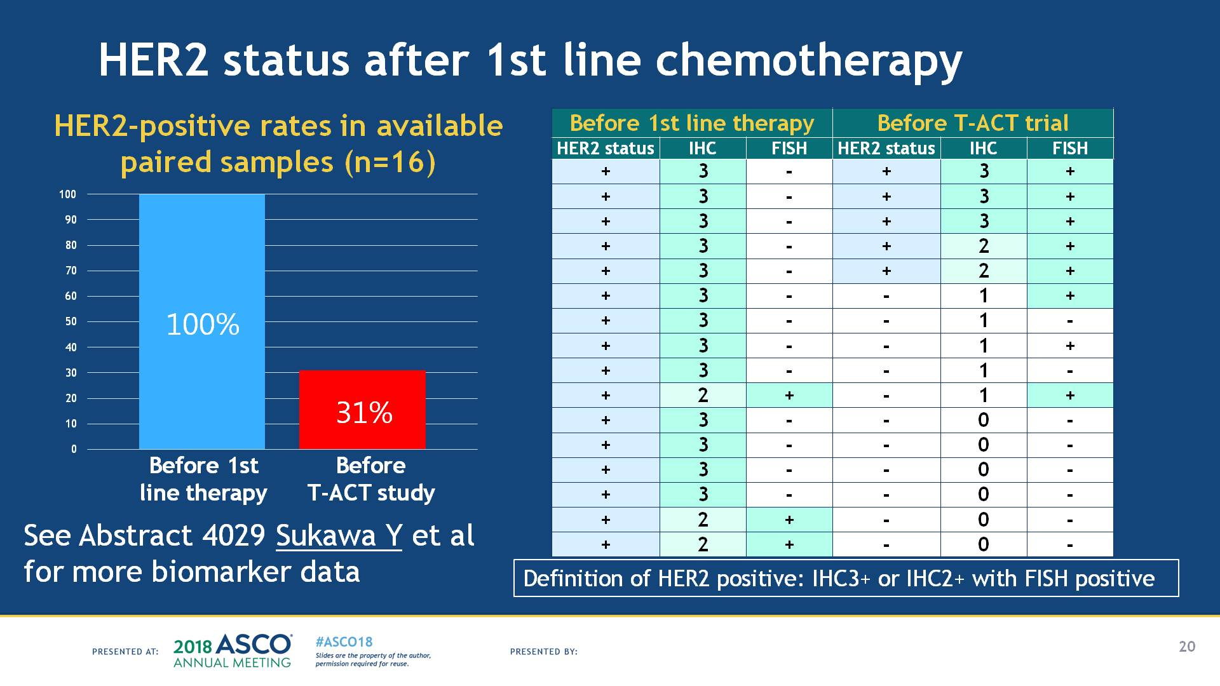
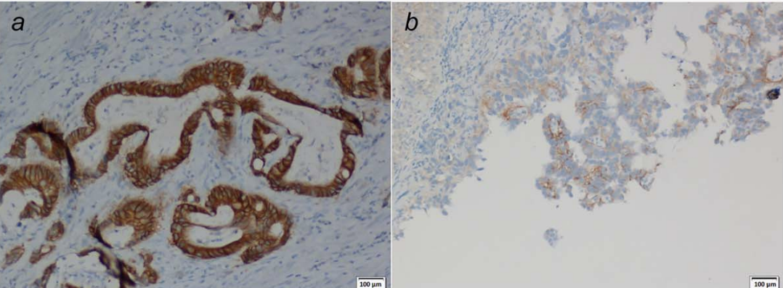
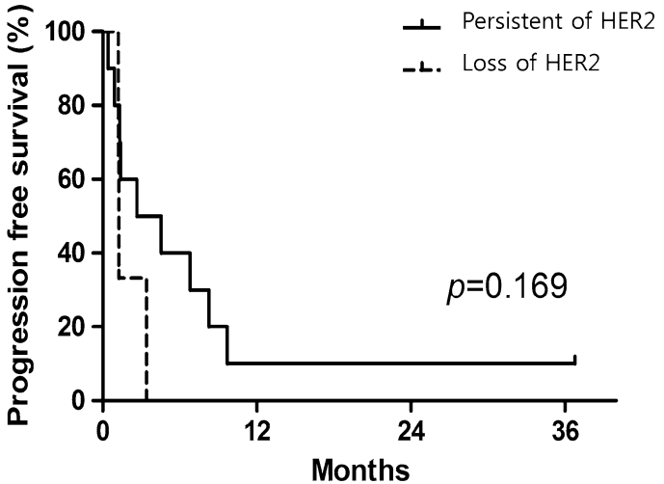
“Loss” of HER2 Expression After Trastuzumab
T-ACT Trial
GASTHER3
HER2 Expression Post Trastuzumab
14/43 patients with loss of HER2 expression after trastuzumab
Post trastuzumab + cisplatin + 5FU
Baseline
Impact of HER2 status on PFS
Tumor HER2 Status, % | Pretreatment (N = 22) | Post-treatment (N = 22)
Positive | 100 | ⁵⁹
Negative | - | 27
Not assessable | - | 14
Overexpressed | 100 | 68
Loss of expression | - | 32
HER2 positivity defined as IHC3+ or IHC2+ with FISH positive
Makiyama. ASCO 2018. Abstr 4011. Seo. Gastric Cancer. 2019;22:527. Pietrantonio. Int J of Cancer. 2016; 139: 2859.

Slide 66
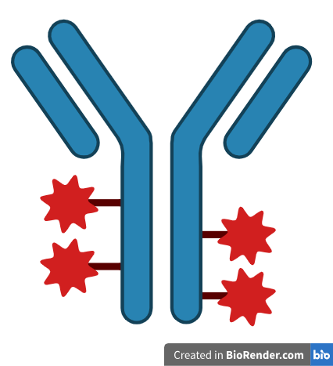
Trastuzumab deruxtecan (T-DXd): Know your DESTINY
 | Phase | Line | Regimen | Key Outcomes
DESTINY-Gastric01 (HER2+) | 2 | ≥3L | T-DXd vs Investigator’s choice Conducted in Japan and South Korea | ORR: 51% vs 14% p<0.001 PFS: 5.6 vs 3.5 mo HR= 0.47; 95% CI, 0.31–0.71 OS: 12.5 vs 8.4 mo HR= 0.59; 95% CI, 0.39–0.88
DESTINY-Gastric02 | 2 | ≥2L | T-DXd Conducted in US and EU | ORR= 42% 95% CI 30.8–53.4 PFS: 5.6 mo 95% CI 4.2–8.3 OS: 12.1 mo 95% CI 9·4–15·4
Composed of an anti-HER2 mAb, cleavable linker, and a topo I inhibitor payload
High DAR (8:1)
Significant bystander effect
John Strickler, MD
Shitara et al., NEJM 2020; 382: 2419-2430.
Van Cutsem et al., Lancet Oncol 2023; 24(7):744-756.

Slide 67
Blood-based biomarkers predict benefit from T-DXd
Exploratory biomarker analysis of the randomized, phase 2 DESTINY-Gastric01 trial
 | Subgroup | N | ORR, % (95% CI)
Plasma HER2 amplification | No amplification | 38 | 34.2 (19.6–51.4)
 | Amplification | 71 | 60.6 (48.3–72.0)
Plasma HER2 copy number | Low/ below median | 53 | 39.6 (26.5–54.0)
 | High/ above median | 56 | 62.5 (48.5–75.1)
HER2 apCN | Low or no amp. (<median) | 52 | 30.8 (18.7–45.1)
 | High (≥median) | 57 | 70.2 (56.8–81.6)
Serum HER2 ECD | Low (<median) | 56 | 42.9 (29.7–56.8)
 | High (≥median) | 62 | 59.7 (46.4–71.9)
Shitara et al., Nature Medicine (2024) 30:1933-1942.

Slide 68
DESTINY-Gastric04: 2L T-DXd versus ramucirumab + paclitaxel
Phase 3, randomized, open-label, global multicenter study for 2L treatment of unresectable/ metastatic HER2+ GEA
Key eligibility criteria
Progression on 1L trastuzumab containing regimen
Unresectable/ metastatic gastric or GEJ adenocarcinoma
Centrally confirmed HER2+ (IHC 3+ or IHC2+/FISH+) after PD on trastuzumab-based therapy
ECOG 0-1
Randomization 1:1
N= 494
T-DXd
6.4mg/kg IV Q3week
N= 246
Ramucirumab + paclitaxel
N= 248
Stratification factors: HER2 status (IHC3+ vs IHC2+/FISH+), region (Asia vs EU vs China vs ROW), 1L TTP (< 6 mo vs >6mo)
Primary endpoint: Overall survival
Secondary endpoints: PFS, ORR, DOR, DCR
Shitara et al., N Engl J Med 2025;393:336-48..

Slide 69
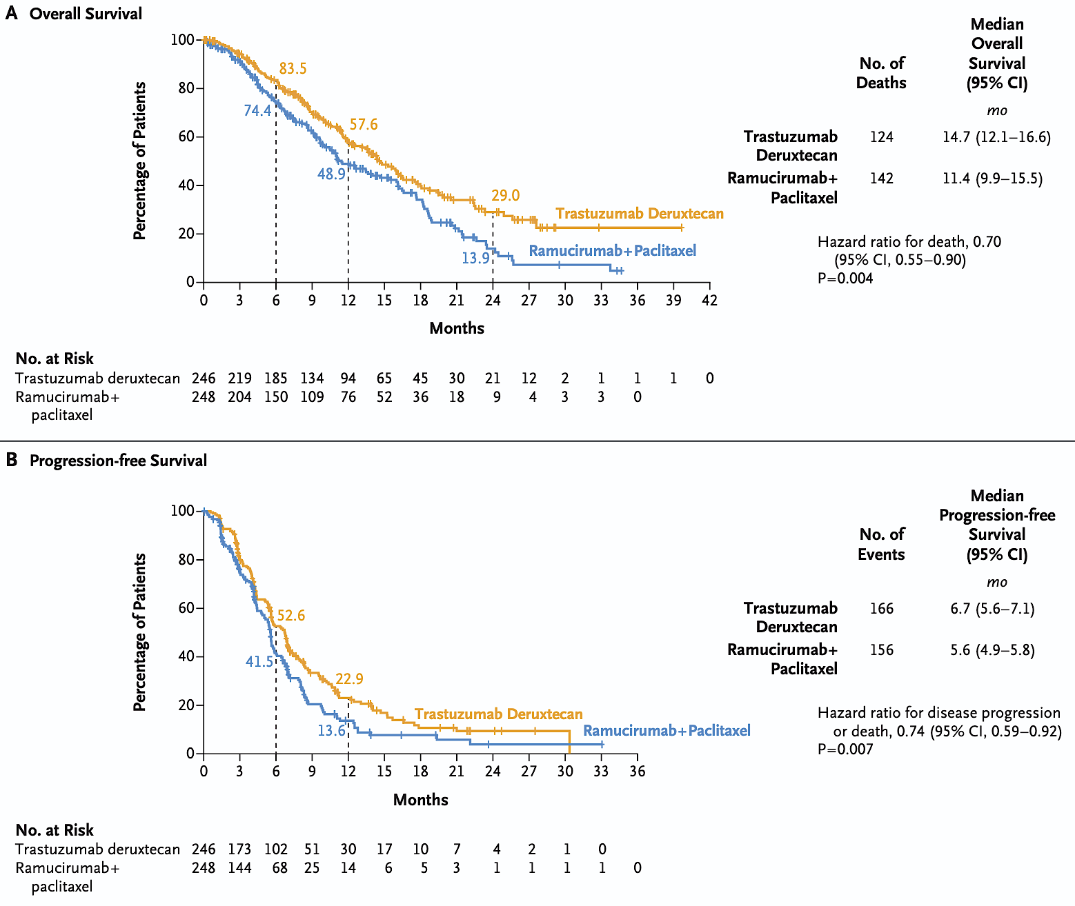

Overall Survival and Progression-free Survival
 | T-DXd | Ram + paclitaxel | HR
OS, months (95% CI) | 14.7 (12.1-16.6) | 11.4 (9.9-15.5) | 0.70 (0.55-0.9) P= 0.004
PFS, months (95% CI) | 6.7 (5.6-7.1) | 5.6 (4.9-6.8) | 0.74 (0.59-0.92) P= 0.007
Shitara K et al. N Engl J Med 2025;393:336-348.

Slide 70
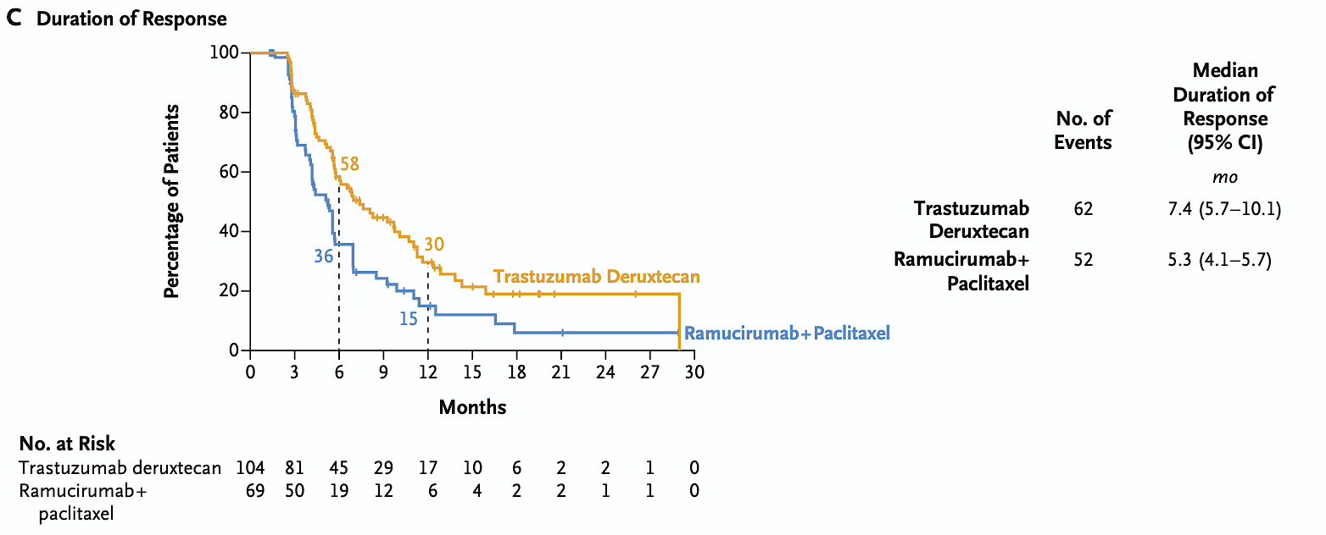
Duration of Response
 | T-DXd | Ram + paclitaxel
ORR (95% CI) | 44.3% (37.8-50.9) | 29.1% (23.4-35.3)
Shitara K et al. N Engl J Med 2025;393:336-348.

Slide 71
What is the Right Dose?
Safety
 | T-DXd | Ramucirumab + paclitaxel
TRAEs | 93.0% | 91.4%
Treatment related SAEs | 18.4% | 17.6%
Grade ≥ 3 TRAEs | 50.0% | 54.1%
TRAE leading to discontinuation | 11.5% | 13.3%
Drug-related ILD/ Pneumonitis | 13.9% | 1.3%
-Destiny CRC02 showed no efficacy advantage of T-DXd
6.4 mg/kg > 5.4 mg/kg
-5.4 mg/kg had much less toxicity
John Strickler, MD
Shitara et al., N Engl J Med 2025;393:336-48..

Slide 72
How to optimize real world efficacy and tolerability of T-DXd
Retrospective, observational, study of 101 patients with metastatic GEA treated with T-DXd
Single institution study in Japan
All patients had HER2+ disease (IHC 3 + or IHC 2 + /ISH-positive)
All patients had prior treatment with trastuzumab-containing regimen
  HER2 status assessable in 33 pts
  HER2 status converted to negative in 39% of patients
Question | Findings
What is the impact on efficacy when HER2 converts to negative? | ORR lower in pts who lose HER2 prior to treatment (31% vs 56%)
What is the impact of using a lower dose (5.4mg/kg) on efficacy? | No apparent loss of efficacy, possible improved tolerability in frail patients
What features might predict ILD/ pneumonitis? | ILD more frequent in patients treated at 6.4mg/kg, primary tumor removed, lower tumor burden
HER2 retesting advised if safe/ feasible
Consider a lower dose of T-DXd in elderly/ frail patients
Jubashi et al., Gastric Cancer (2025) 28:63–73.

Slide 73
Is there a role for T-DXd for HER2-intermediate or HER2-low metastatic GEA?
DESTINY-Gastric01 Exploratory Cohorts
 | Cohort 1: Intermediate IHC2+ and FISH- N= 21 | Cohort 2: Low IHC 1+ N= 24
ORR (95% CI) | 26.3% (9.1-51.2) | 9.5% (1.2 to 30.4)
PFS (95% CI) | 4.4 months (2.7-7.1) | 2.8 months (1.5-4.3)
Overall survival (95% CI) | 7.8 months (4.7-NE) | 8.5 months (4.3-10.9)
T-DXd appears active in patients with HER2 intermediate/ low disease
But… additional randomized controlled trials vs SOC needed
Yamaguchi et al., J Clin Oncol (2023) 41(4):816-825.

Slide 74
DESTINY Gastric-03 (T-Dxd combinations)
Part 2 of DESTINY-Gastric03, a Phase 1b/2 trial (NCT04379596), with non-contemporaneous and non-randomized arms
Jul 2020
Jan 2022
Patient population
Adults ≥18 years
Unresectable, locally advanced or metastatic esophageal adenocarcinoma/GC/GEJA
HER2+ (IHC 3+ or IHC 2+/ISH+ per local
assessment)
Treatment naïve for metastatic disease
ECOG PS of 0 or 1
T-DXd 6.4 mg/kg
n=43
T-DXd 6.4 mg/kg +
5-FU/cape*
Sep 2021
Jan 2022
n=42
T-DXd 6.4 mg/kg + 5-FU/cape* + pembro
Dec 2021
Jul 2022
n=43
T-DXd 6.4 mg/kg +
pembro
Jan 2022
Aug 2022
n=41
Part 2 endpoints
T-DXd 5.4 mg/kg + 5-FU/cape† + pembro
Sep 2023
Jan 2024
Primary
Confirmed ORR by investigator assessment
Secondary
ORR, DOR, and PFS by investigator assessment, and OS
Safety and tolerability
Exploratory
Antitumor activity by PD-L1 status
n=32
SOC - trastuzumab +
5-FU/cape + cisplatin/oxaliplatin
Jul
2020
Jul
2021
n=29
2020
2021
2022
Enrollment period
2023
2024 DCO
At DCO of May 6, 2024, median follow up: T-DXd 6.4 mg/kg = 17 months, T-DXd 6.4 mg/kg + 5-FU/cape = 21 months, T-DXd 6.4 mg/kg + 5-FU/cape + pembro = 17 months, T-DXd 6.4 mg/kg + pembro = 15 months, T-DXd 5.4 mg/kg + 5-FU/cape + pembro = 5 months, and SOC = 18 months
T-DXd: IV Q3W. Pembro: 200 mg IV Q3W. SOC: trastuzumab 6 mg/kg IV Q3W, investigator choice of 5-FU 800 mg/m² CIV infusion or cape 1000 mg/kg² BD, and investigator choice of cisplatin 80 mg/m² IV or oxaliplatin
130 mg/m² IV at SOC dose. *Investigator choice of 5-FU 600 mg/m² CIV infusion or cape 1000 mg/m² BD at dose established in Part 1; †investigator choice of 5-FU 600 mg/m² CIV infusion or cape 750 mg/m² BD

Slide 75

Objective response rate and best percentage change from baseline
in target lesion size
 | T-DXd 6.4 mg/kg n=43 |  | T-DXd 6.4 mg/kg + 5-FU/cape 1000 mg/m² n=41 |  | T-DXd 6.4 mg/kg + 5-FU/cape 1000 mg/m² + pembro n=43 |  | T-DXd 6.4 mg/kg + pembro n=41 |  | T-DXd 5.4 mg/kg + 5-FU/cape 750 mg/m² + pembro n=32 |  | SOC - trastuzumab + 5-FU/cape + cisplatin/oxaliplatin n=29
mFollow up, months | 17 |  | 21 |  | 17 |  | 15 |  | 5 |  | 18
mDOR, months (95% CI) | 18 (6, 30) |  | 20 (12, 28) |  | 17 (8, NE) |  | 18 (5, 21) |  | NE (2, NE) |  | 14 (5, 20)
Confirmed ORR, % (95% CI) | 49 (33, 65) |  | 78 (62, 90) |  | 58 (42, 73) |  | 63 (46, 78) |  | 59 (40, 77) |  | 76 (56, 90)
CPS ≥1% | 57 |  | 77 |  | 70 |  | 78 |  | 62 |  | 85
CPS <1% | 53 |  | 73 |  | 39 |  | 44 |  | 46 |  | 71
75
CPS ≥1%
CPS <1%
CPS missing
CPS ≥1%
CPS <1%
CPS missing
CPS ≥1%
CPS <1%
CPS missing
CPS ≥1%
CPS <1%
CPS missing
CPS ≥1%
CPS <1%
CPS missing
CPS ≥1%
CPS <1%
CPS missing
50
Best change from baseline in target lesion size (%)
25
0
−25
−50
−75
−100
Assessments were by Investigator using RECIST 1.1. Best percentage change is the maximum reduction or minimum increase from baseline in the target lesion size; the dashed lines at −30% and 20% change in target lesion size indicate the thresholds for partial response and progressive disease, respectively.

Slide 76
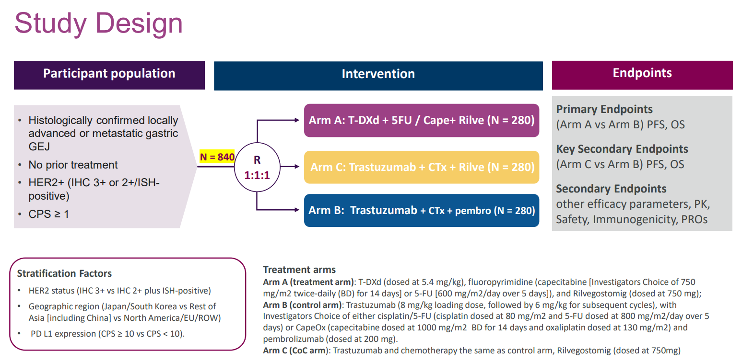
ARTEMIDE-Gastric01 Study

Slide 77
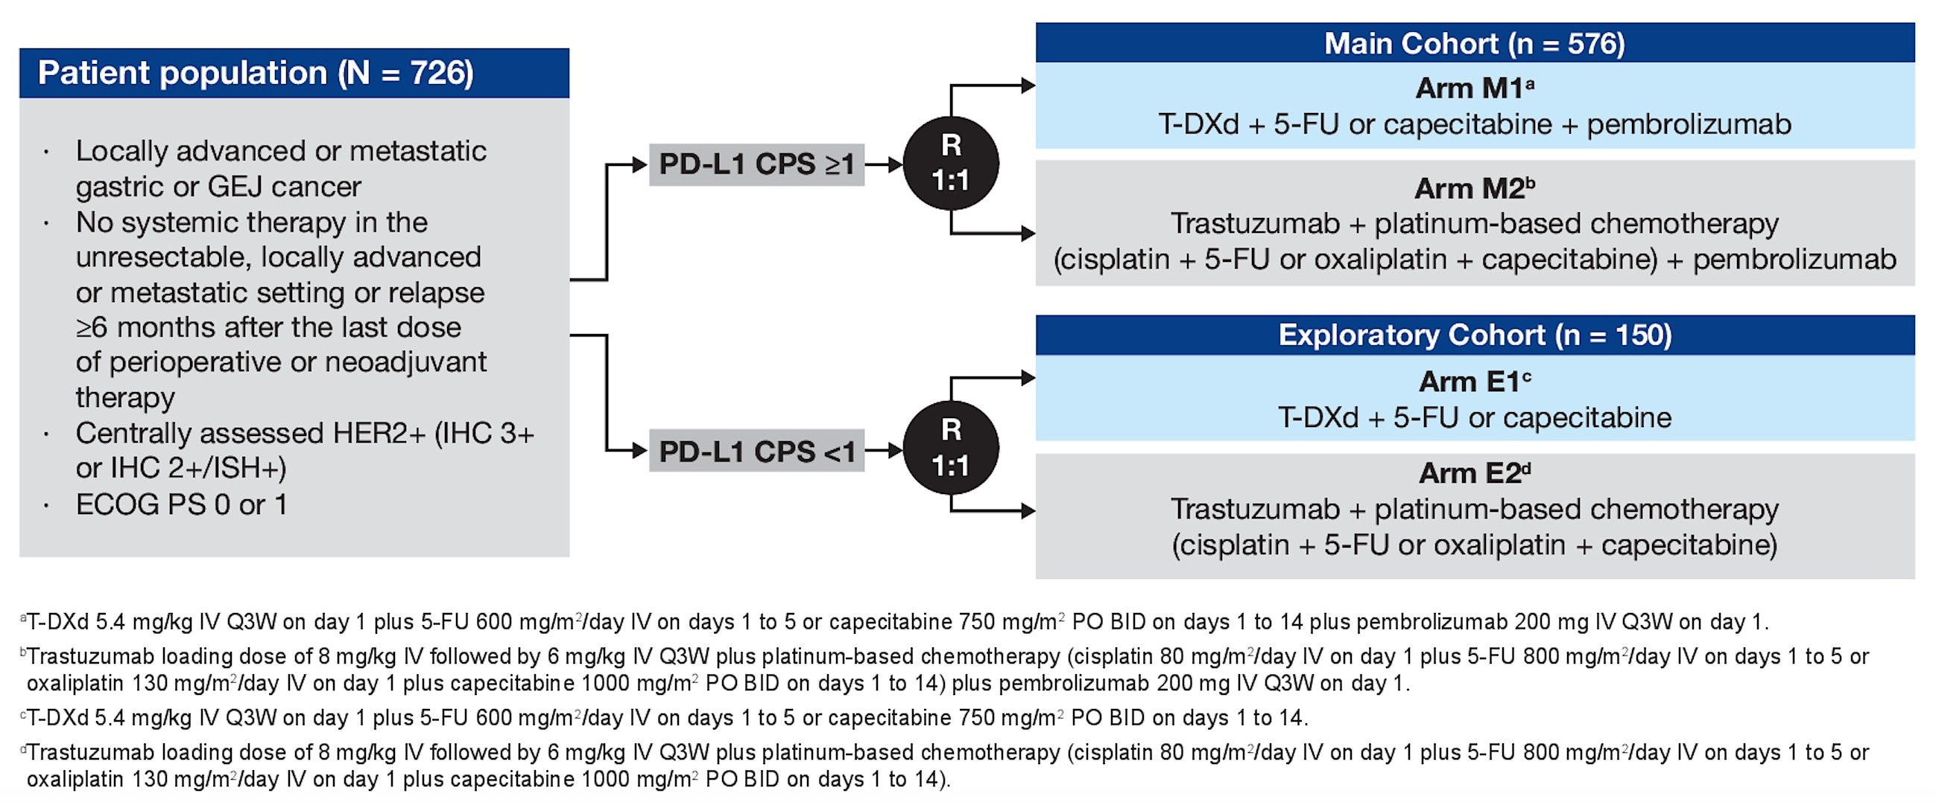
DESTINY-Gastric05 (Open)
Shitara K et al. ASCO 2025; Abstract TPS4207.

Slide 78
Questions from General Medical Oncologists —
Gastroesophageal Cancers
69 yr old male with a hx of Stage II GE cancer treated with the CROSS regimen. Had local recurrence at the GE junction 15 months post-esophagectomy. Tumor was PD-L1-positive (CPS 10) and HER2-positive.
Local recurrence resolved after treatment with FOLFOX/trastuzumab/ pembrolizumab. However, he then developed an isolated brain met, which has been resected. Would you give “adjuvant” T-DXd and for how long?
58 yo male with a HER2+ GE junction tumor treated with FOLFOX6, trastuzumab and nivolumab, progressed with supraclavicular adenopathy and brain mets. Now on second-line treatment with T-DXd. Is there a role for zanidatamab third line?

Slide 79
Questions from General Medical Oncologists —
Gastroesophageal Cancers
56 yo male with Stage IV GEJ cancer with liver mets, PD-L1 CPS 1, HER2 IHC 3+. Quickly progressed on pembrolizumab + trastuzumab + FOLFOX. We planned to give T-DXd as 2nd-line tx. Unfortunately, the repeat bx shows HER2 IHC 2+, FISH-negative, but NGS is positive for an ERBB2 activating mutation. Can I now proceed with T-DXd? What anticipated ORR and PFS should be conveyed to this pt and their family?
53 yo M with HER2-amplified metastatic GEJ adenocarcinoma, PD-L1-positive. Progressed on FOLFOX + pembro + trastuzumab. Before considering HER2-targeted options in the 2nd line, how important is it to rebiopsy? Is there any role for HER2-targeted therapy in HER2 IHC 1+ or 2+ disease?

Slide 80
Questions from General Medical Oncologists —
Gastroesophageal Cancers
73-year-old female with 6-month history of dysphagia, found on endoscopy to have semi-obstructive GEJ adenocarcinoma, HER2+ by IHC and FISH, no nodal or distant spread on imaging. What neoadjuvant approach would you recommend?

Slide 81
Questions from General Medical Oncologists —
Gastroesophageal Cancers
56 yo male w/metastatic GEJ cancer. Progressed on FLOT + nivolumab.
New liver lesion noted. Biopsy is HER2-positive, PD-L1 CPS >1. Should I consider 5-FU + oxaliplatin + trastuzumab + pembrolizumab? Is durvalumab better? What about T-DXd for this patient?

Slide 82
Agenda
Module 1: Biliary Tract Cancers — Dr Ellis
Module 2: Gastroesophageal Cancers — Dr Wainberg
Module 3: Colorectal Cancer — Prof Van Cutsem

Slide 83


Integrating Therapies Targeting HER2 in mCRC
Prof Eric Van Cutsem, MD, PhD
Digestive Oncology
Leuven, Belgium
Eric.VanCutsem@kuleuven.be

Slide 84
HER2 Positivity in mCRC and Detection Methods
NCCN & ESMO Living guidelines recommend HER2 testing according to the HERACLES criteria or through next-generation sequencing (NGS) in mCRC
  HER2 positivity is defined by intense circumferential, basolateral, or lateral immunohistochemical staining (IHC 3+) in ≥ 50% of tumor cells. If the staining is observed in > 10% but < 50% of cells, a positive in situ hybridization (ISH) result (HER2/CEP17 ratio ≥ 2 in ≥ 50% of cells) is required to confirm HER2 positivity
  moderate circumferential, basolateral, or lateral staining (IHC 2+) in ≥ 50% of cells also require a positive ISH result to be considered HER2 positive
Unlike in breast and gastric cancer, HER2 positivity in CRC lacks a standardized definition.
  compared with breast and gastric cancer, the HERACLES classification demands a higher proportion of tumor cells to exhibit staining (≥ 50% versus ≥ 10%) and it allows a broader range of staining patterns.
A key challenge in HER2 detection in mCRC is intratumoral heterogeneity
SO: multiple methodologies can be used for HER2 assessment in mCRC.
Notably, gene-based approaches may offer advantages overcoming intratumoral heterogeneity and ctDNA can potentially overcome heterogeneity between primary and metastasis and increase detection rates.
As a result, incorporating NGS and liquid biopsy into diagnostic workflows could further refine
patient selection for HER2- targeted therapies
Vaghi C et al, Drugs 2025, Nov 17. doi: 10.1007/s40265-025-02253-2

Slide 85
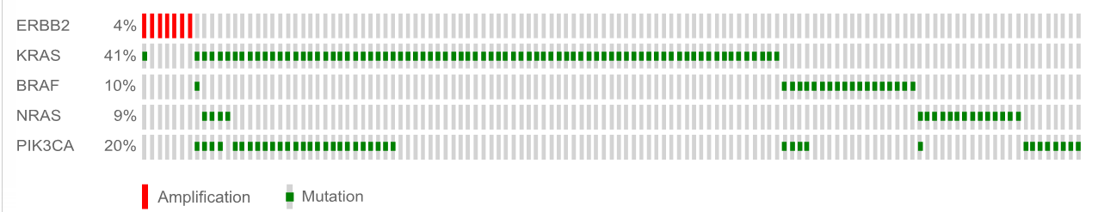
HER2 Amplification in Patients With Colorectal Cancer
Study | N | Positive Rate | IHC 2+ (Borderline) | IHC 3+ (Positive) | IHC/FISH Concordance
Nathanson¹ | 139 | IHC: 5 (3.6%) FISH: 4 (2.4%) | 2 | 3 | K = 0.89
Ooi² | 244 | IHC: 8 (3%) FISH: 8 (3%) | 2 | 6 | 100%
Marx³ | 1439 | IHC: 39 (3%) FISH: 36 (3%) | 12 | 27 | 100%
Summary | 1822 |  | 16 | 36 | Good
HER2 overexpression and amplification is seen in a distinct subset of mCRC
Unselected (n = 2349)
(patients)
KRAS wild type (n = 44)
(patients)
Quadruple negative (n = 11)
(xenopatients)
ERBB2 4%
KRAS 41%
2.7%
(2.5-3.7%)
13.6%
(P < .01%)
36.4%
(P < .001)
BRAF 10%
NRAS 9%
PIK3CA 20%
HER2 amplification
Amplification Mutation
5% HER2 amplification seen in HERACLES Study (screened = 914)⁴
HER2 amplification enriched in KRAS, NRAS, BRAF, and PIK3CA WT tumors and in left sided tumors^{5,6}
1. Nathanson et al. Int J Cancer. 2003; 105:796. 2. Ooi et al. Mod Pathol. 2004;17:895 3. Marx A et al. Human Path. 2010;41:1577.
4. Sartore-Bianchi A…Siena S . Lancet Oncol 2016. 5. Bertott A et al, Cancer Discovery 2011;1:508. 6. Kuwada et al . Int J Cancer. 2004;109:291.

Slide 86
HER2 Amplification in Patients With Colorectal Cancer
HER2 overexpression/amplification:
  3% (unselected) to 5% (RAS and BRAF wild-type molecular profiles) of mCRCs
  predominantly in left-sided colon and rectal adenocarcinomas
  associated with metastases in the central nervous system.
HER2 mutations: 1-2% of CRC
Prognostic impact of HER2 amplification: controversial results
However the largest combined analysis of 1604 patients in 8 trials: TRIBE2,
TRIPLETE, VALENTINO, ATEZOTRIBE, PANDA, PANAMA, PARADIGM,
CALGB/SWOG80405
  HER2-positivity and mutation
    negative prognostic factors in pMMR/MSS, RAS/BRAF wild-type mCRC
    do not predict benefit from bev/anti-EGFRs in pMMR/MSS, RAS/BRAF wild-type mCRC

Slide 87
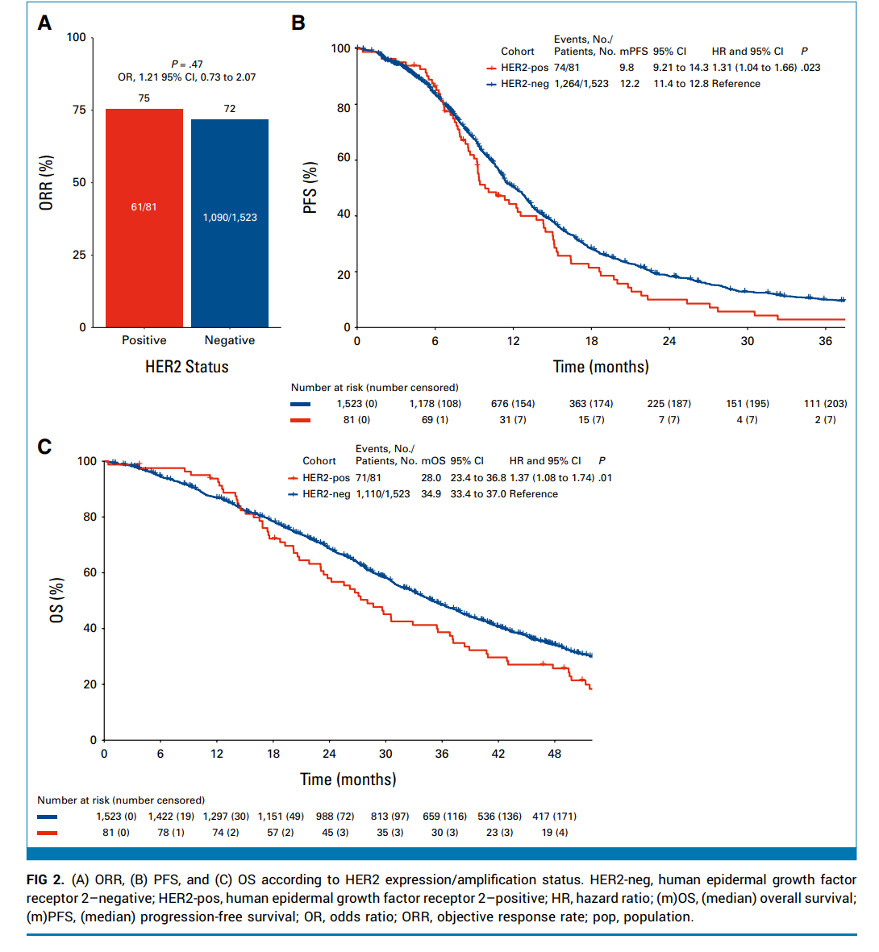
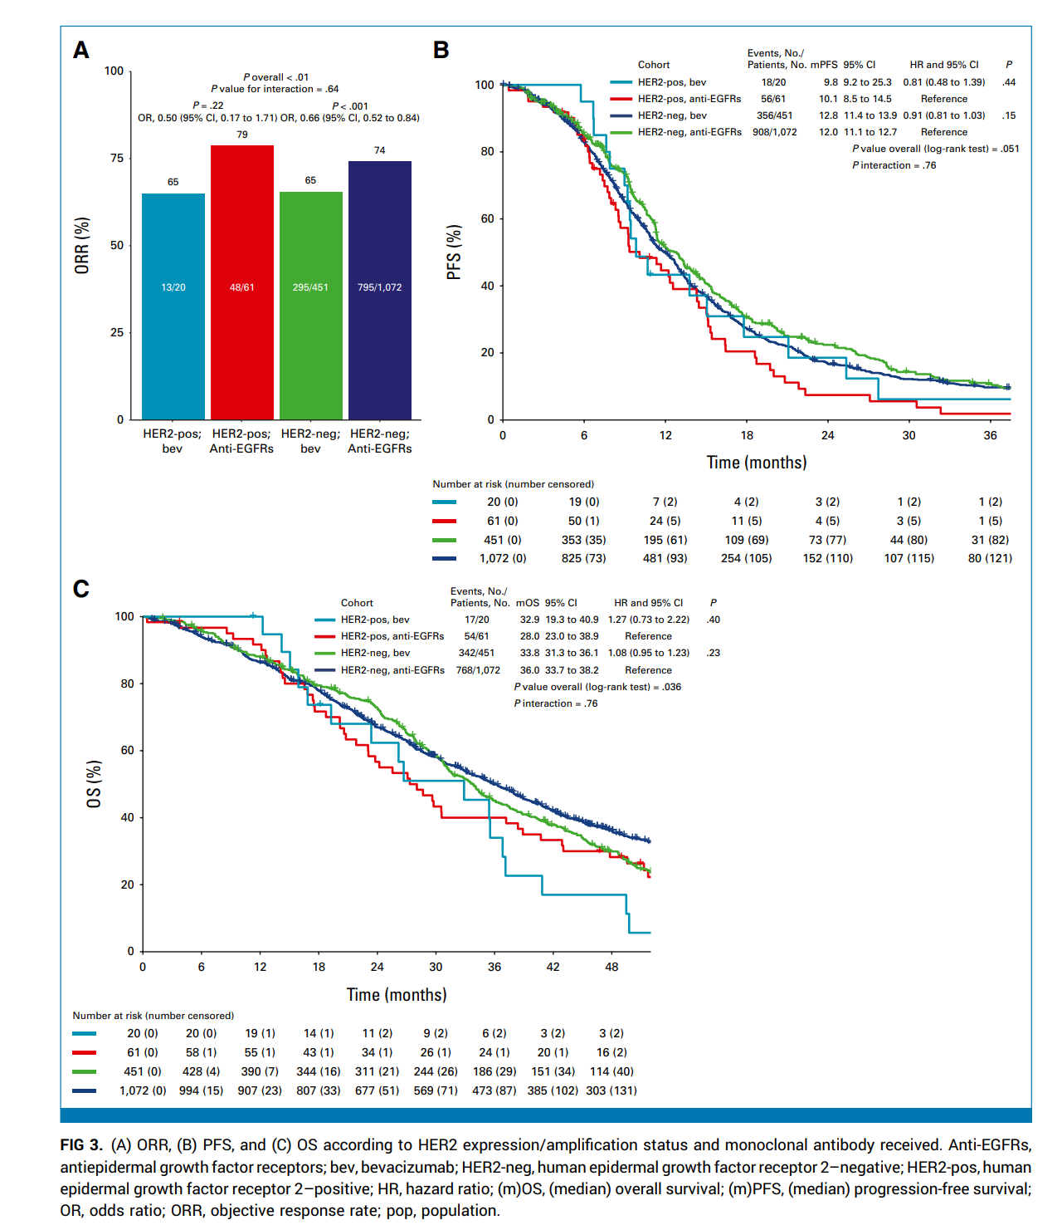
Impact of HER2 in Patients With mCRC Treated With CT + Bevacizumab
or Anti-EGFRs: HER2 expression/amplification
Germani M et al, J Clin Onc 2025, 43:3184-3197

Slide 88
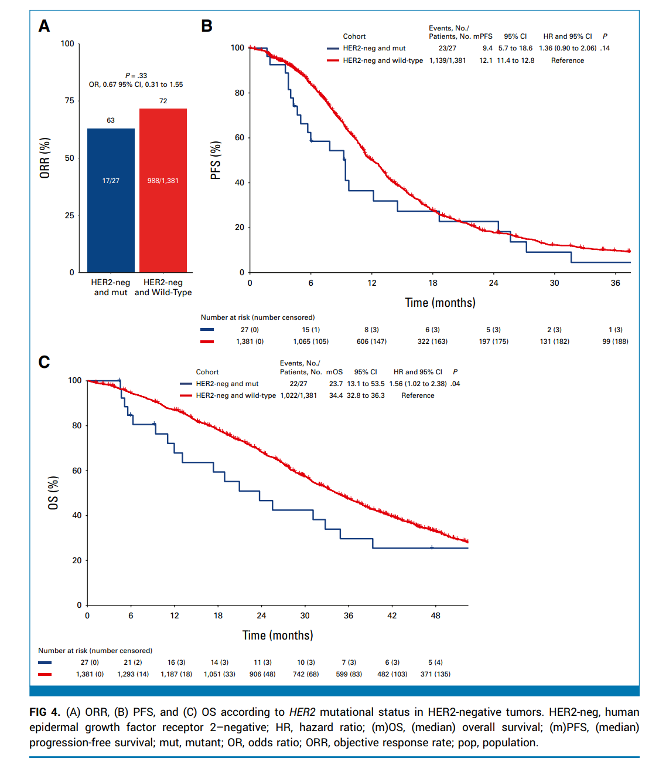
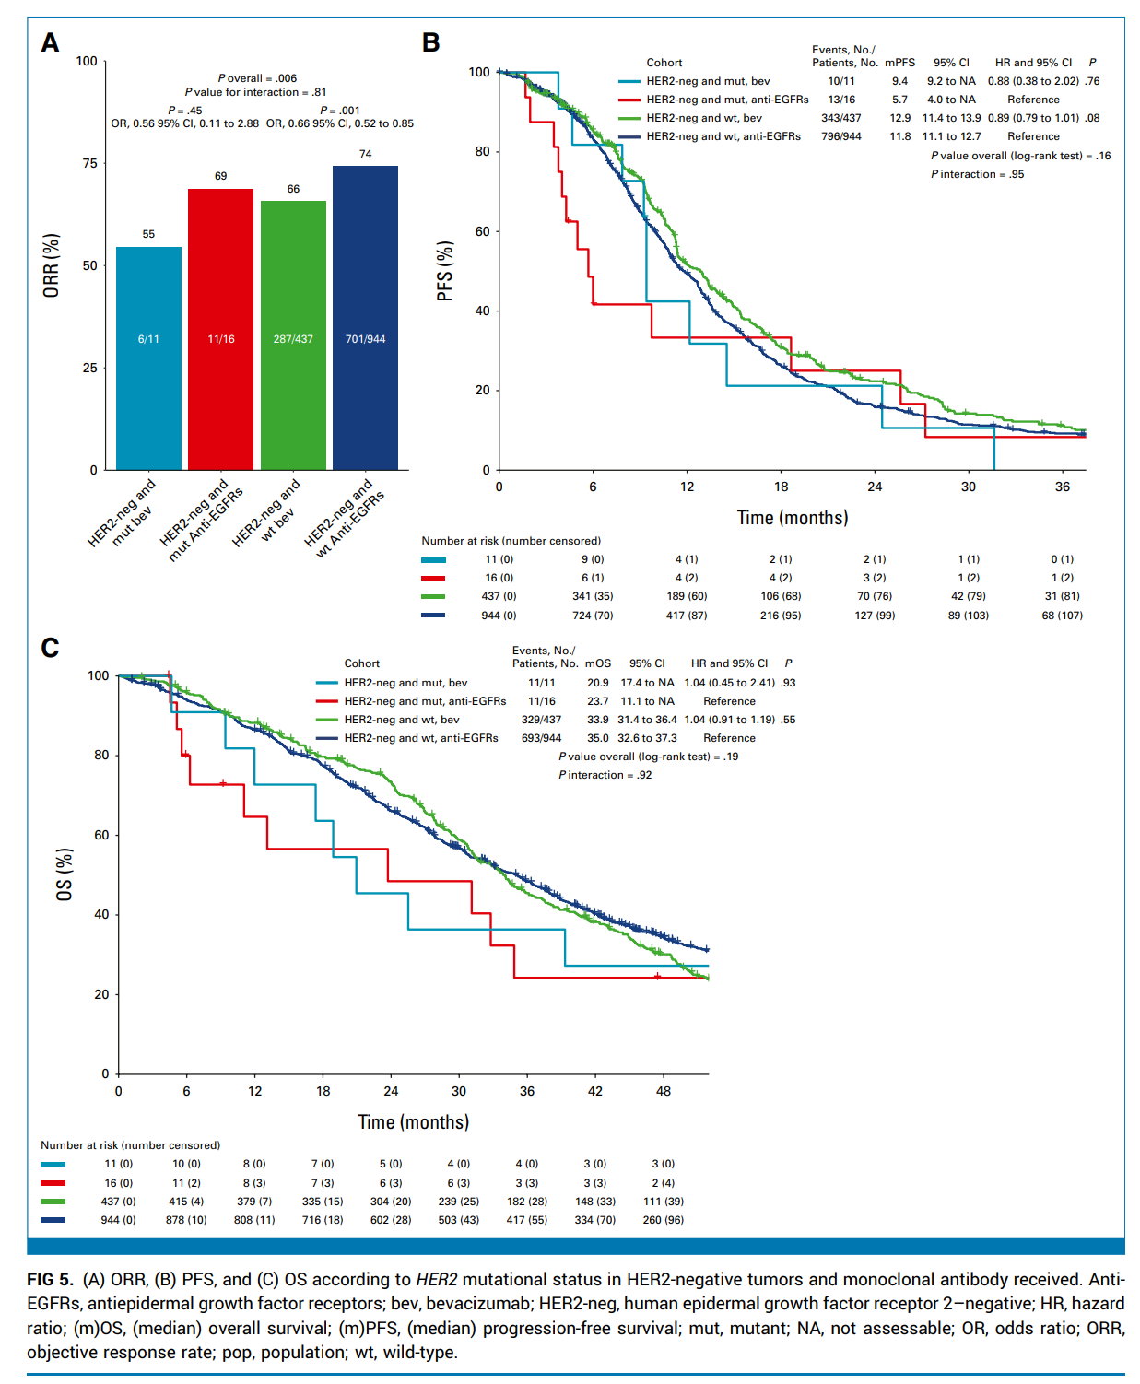
Impact of HER2 in Patients With mCRC Treated With CT + Bevacizumab or Anti-EGFRs: HER2 mutation
Germani M et al, J Clin Onc 2025, 43:3184-3197

Slide 89
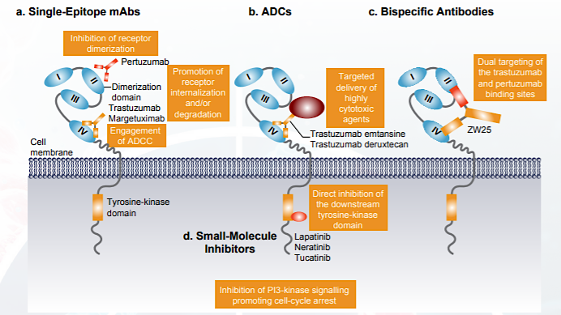
Mechanism of Action of HER2-Targeting Therapies
Oh DY et al Nat Rev Clin Oncol. 2020;17:33-48.

Slide 90
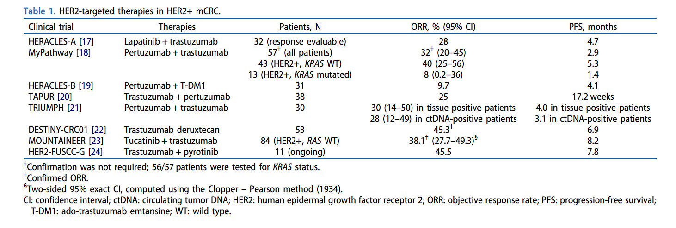
HER2-targeted therapies in mCRC
Strickler J ....Van Cutsem E et al, Future Oncol 2025

Slide 91
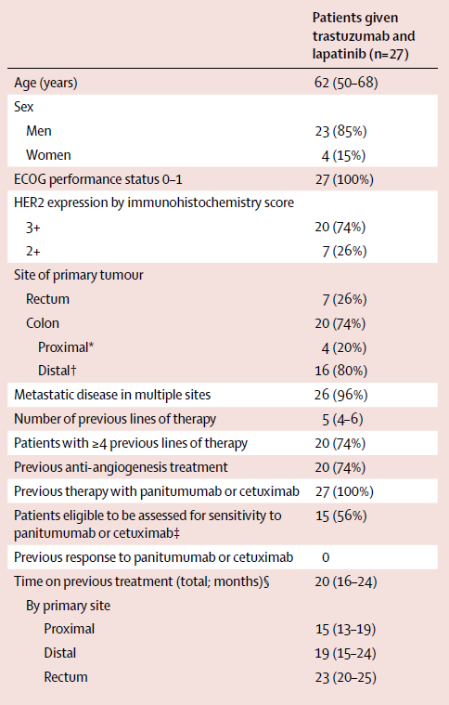
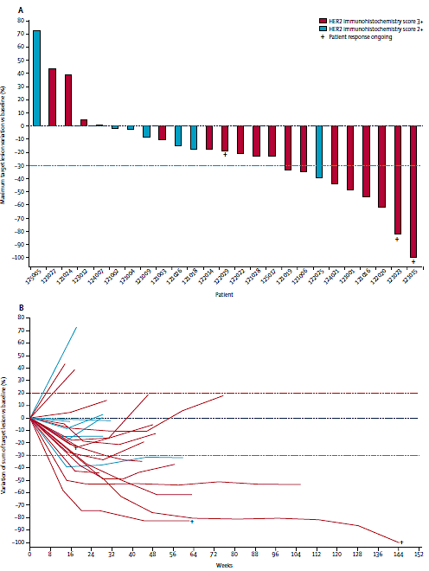
HER2-targeted therapy in mCRC: HERACLES-A
PFS according to HER2 GCN
≥9.45
<9.45
Sartore-Bianchi A … Siena S, Lancet Oncol 2016

Slide 92
MOUNTAINEER: Global, Open-Label, Phase 2 Trial of Tucatinib and Trastuzumab in HER2+ mCRC
Key Eligibility Criteria
≥2L mCRC
HER2+ per local IHC/ISH/NGS testing
RAS wild-type
Measurable disease per RECIST 1.1
Prior fluoropyrimidines, oxaliplatin, irinotecan, and anti-VEGF mAb
Cohort A (n=45)
Tucatinib 300 mg PO BID
+
Trastuzumab 6 mg/kg Q3W (loading dose 8 mg/kg C1D1)^{a,b}
Cohort B (n=41)
Tucatinib 300 mg PO BID
+
Trastuzumab 6 mg/kg Q3W (loading dose 8 mg/kg C1D1)^{a,b}
Endpoints
Efficacy
Assessed in patients who received any amount of study treatment and had HER2+ tumors^{e}
1. Primary: Confirmed ORR in Cohorts A+B (RECIST 1.1 per BICR)
2. Secondary:
Cohorts A+B: DOR per BICR, PFS per BICR, and OS
Cohort C: ORR by 12 weeks of treatment (RECIST 1.1 per BICR)
Safety presented in Cohorts A+B who received any amount of study treatment
R^{c}
Expansion
Cohort C (n=31)
Tucatinib 300 mg
PO BID^{a,d}
MOUNTAINEER began as a US Investigator-Sponsored Trial and initially consisted of a single cohort (Cohort A) and was expanded globally to include patients randomised to receive tucatinib + trastuzumab (Cohort B) or tucatinib monotherapy (Cohort C)
Data cut-off for current analysis, March 28, 2022
a Each treatment cycle is 21 days; b Patients remained on therapy until evidence of radiographic or clinical progression, unacceptable toxicity, withdrawal of consent, or study closure; c Stratification: Left sided tumor primary vs other; d Patients were allowed to cross over and receive tucatinib and trastuzumab if they experienced radiographic progression at any time point or if they had not achieved a PR or CR by week 12; e Patients had HER2+ tumors as defined by one or more protocol
required local tests: IHC 3+ (n=46), amplification by ISH (n=36), or amplification by NGS (n=69)
https://clinicaltrials.gov/ct2/show/NCT03043313
Strickler JH…Van Cutsem E et al. Lancet Oncol. 2023; Strickler JH… Van Cutsem E et al. ASCO 2024; Abstract 3509.

Slide 93
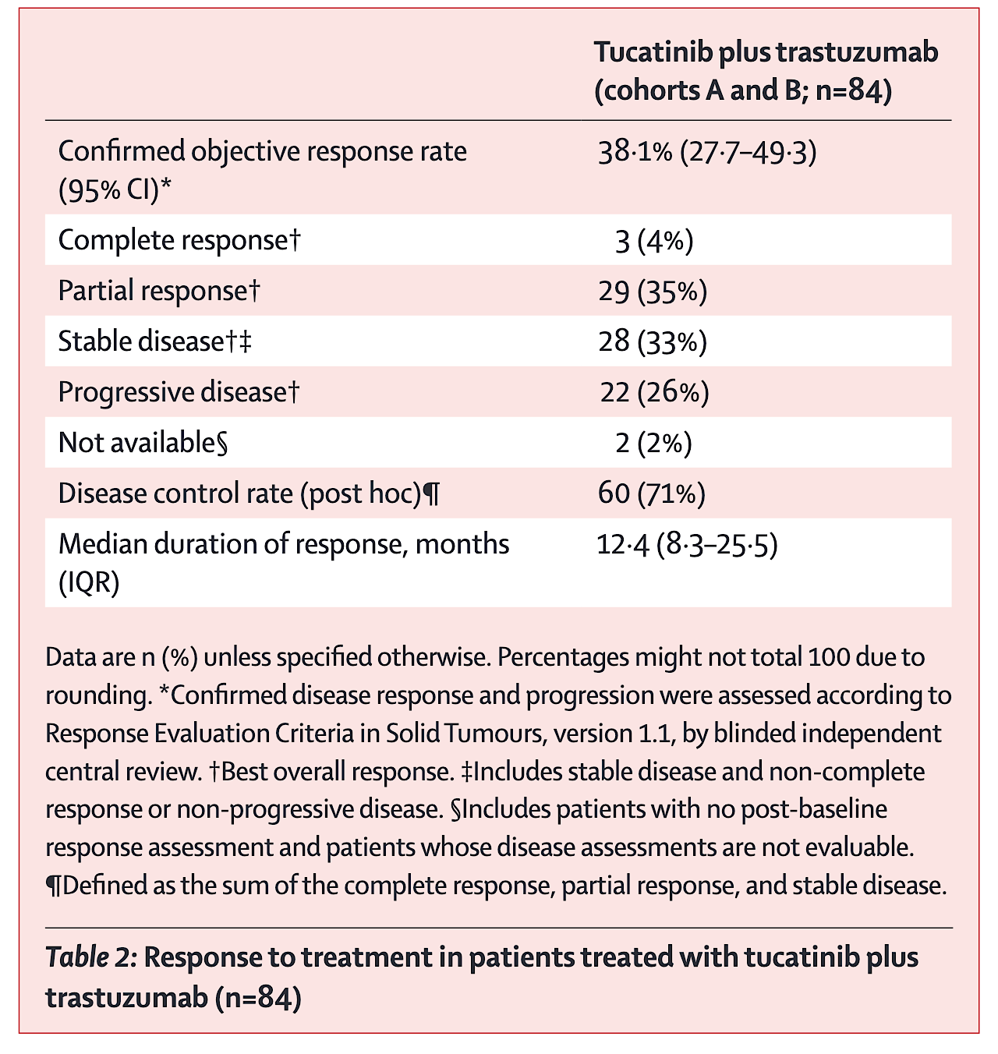
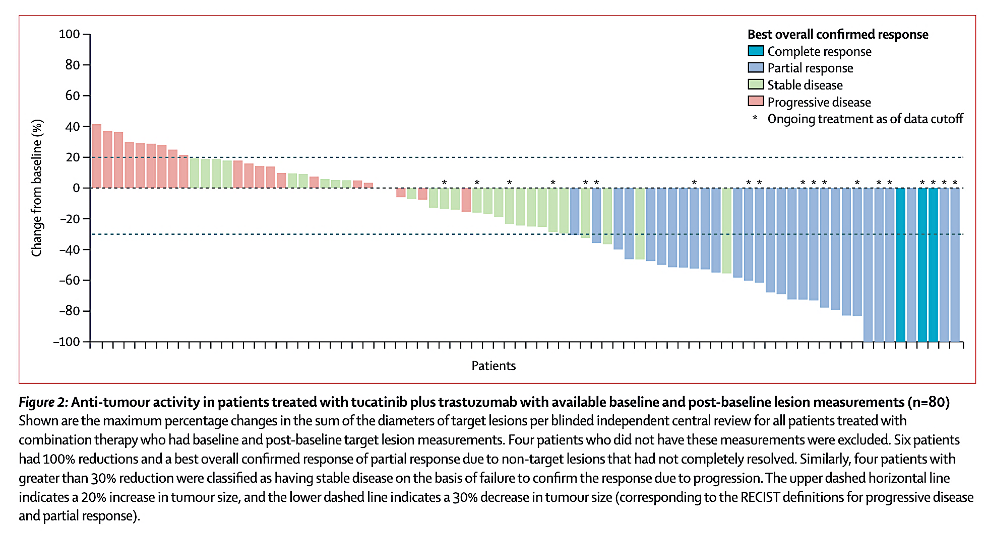
MOUNTAINEER: Global, Open-Label, Phase 2 Trial of Tucatinib and Trastuzumab in HER2+ mCRC
Post-hoc subgroup analysis by HER2 status according to immunohistochemistry:
confirmed ORR by BICR
  46·7% (95% CI 31·7–62·1; 21 of 45 patients) in those with IHC 3+ tumours,
  20·0% (4·3–48·1; three of 15 patients) in those with IHC 2+ and in-situ hybridisation-positive tumours
  10·0% (0·3–44·5; one of ten patients) in those with HER2-negative tumours
Strickler JH…Van Cutsem E et al. Lancet Oncol. 2023; Strickler JH… Van Cutsem E et al. ASCO 2024; Abstract 3509.

Slide 94
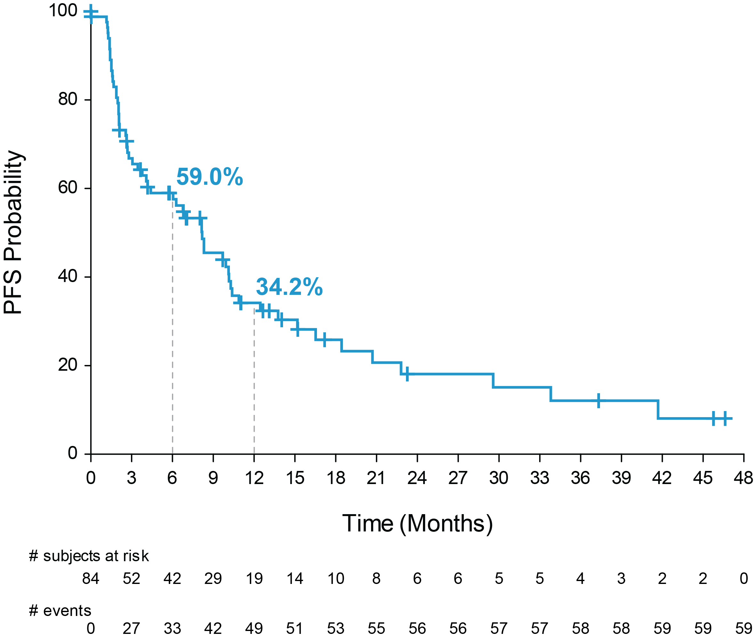
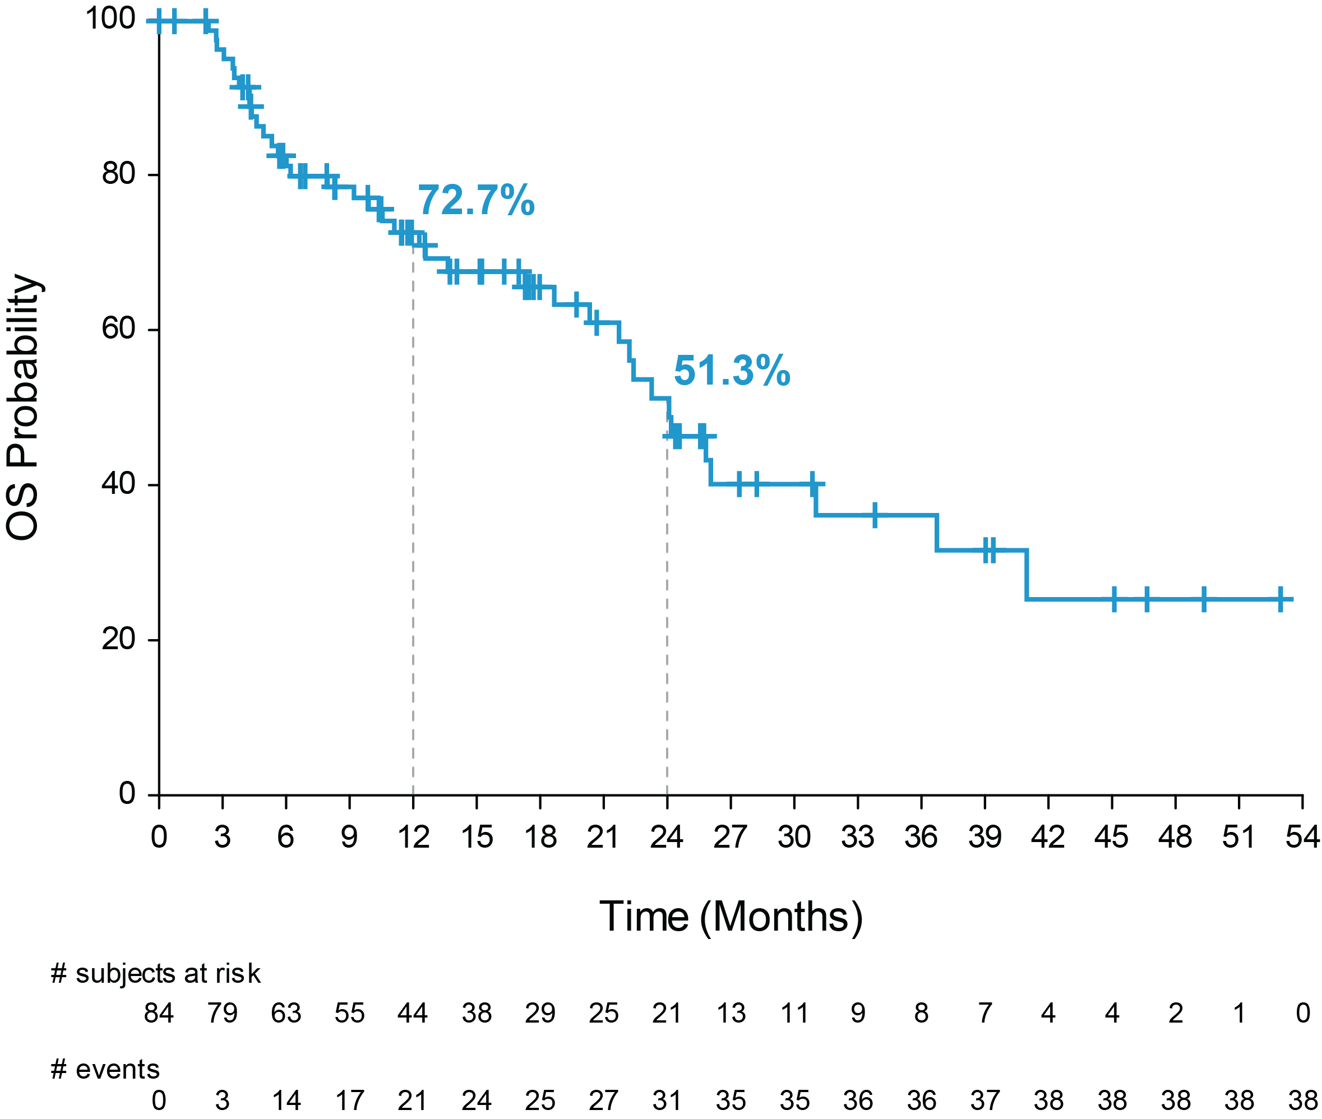
MOUNTAINEER: Global, Open-Label, Phase 2 Trial of Tucatinib and Trastuzumab in HER2+ mCRC
Progression-free Survival per BICR
Overall Survival
Tucatinib + Trastuzumab | Events | Median PFS | 95% CI
Cohorts A+B | 59/84 | 8.1 months | 4.2, 10.2
Tucatinib + Trastuzumab | Events | Median OS | 95% CI
Cohorts A+B | 38/84 | 23.9 months | 18.7, 28.3
Median follow-up for Cohorts A+B in final analysis was 32.4 months.
BICR, blinded independent central review; IQR, interquartile range; OS, overall survival; PFS, progressive-free survival.
Data cutoff: 28 Mar 2022
Strickler JH…Van Cutsem E et al. Lancet Oncol. 2023; Strickler JH…Van Cutsem E et al. ASCO 2024; Abstract 3509.

Slide 95

MOUNTAINEER: Efficacy by
Central HER2 Testing Methods
Strickler JH…Van Cutsem E et al. ASCO 2024; Abstract 3509.

Slide 96

Most Common TEAEs for Tucatinib + Trastuzumab
Most common tucatinib-related AEs: diarrhoea (52.3%), fatigue (29.1%), nausea (18.6%), and dermatitis acneiform (17.4%)
  Grade ≥3 tucatinib-related AEs (≥3%): alanine aminotransferase increase (2.3%) and diarrhoea (2.3%)
Strickler JH…Van Cutsem E et al. Lancet Oncol. 2023; Strickler JH…Van Cutsem E et al. ASCO 2024; Abstract 3509.
Data cutoff: 28 Mar 2022

Slide 97
MOUNTAINEER-03 trial in first line mCRC
MOUNTAINEER-03 (NCT05253651) is a global, open-label, randomized, phase 3 study of tucatinib with trastuzumab and mFOLFOX6 versus standard of care for the first-line treatment of HER2+ and RAS wild-type mCRC
Study Population
Treatment
Endpoints
Measurable disease per RECIST v1.1
ECOG PS 0-1
HER2+, RAS WT, mCRC
No prior treatment in metastatic setting
May have received adjuvant treatment if completed
>6 months prior to enrollment
Tucatinib experimental arm
Tucatinib 300 mg PO BID
Trastuzumab 8 mg/kg loading dose,
then 6 mg/kg IV (Q3W)
mFOLFOX6 (Q2W)
Primary
・ PFS per RECIST v1.1 by BICR assessment
Secondary
・ OS ・ PFS2
・ cORR ・ Safety
・ PFS ・ PK
・ DOR ・ PROs
N≈400ª
Randomize 1:1
Standard-of-care control arm
mFOLFOX6 (Q2W), or
mFOLFOX6 (Q2W) + bevacizumab (Q2W),
or
mFOLFOX6 (Q2W) + cetuximab (QW)
a Stratification by both primary tumor location (left-sided versus all other) and liver metastases (presence or absence)
BICR, blinded independent central review; BID, twice a day; cORR, confirmed objective response rate; DOR, duration of response; ECOG PS, Eastern Cooperative Oncology Group Performance Status; HER2, human epidermal growth factor receptor 2; IV, intravenously; mCRC, metastatic colorectal cancer; mFOLFOX6, modified 5-fluorouracil, leucovorin, and oxaliplatin; OS, overall survival;
PFS, progression-free survival; PFS2, time from randomization to disease progression on next-line treatment or death from any cause; PK, pharmacokinetics; PO, by mouth; PROs, patient-reported outcomes; Q, each; RAS, rat sarcoma virus; RECIST, Response Evaluation Criteria in Solid Tumors; W, week; WT, wild-type.
Strickler J ....Van Cutsem E et al, Future Oncol 2025

Slide 98

DESTINY-CRC01 Study Design
Siena S et al, Lancet Oncol 2021
Yoshino T et al, Nat Comm 2023

Slide 99

DESTINY-CRC01 trial
Yoshino T et al, Nat Comm 2023

Slide 100


DESTINY-CRC01 trial: analysis according to IHC of HER2
Yoshino T et al, Nat Comm 2023

Slide 101
DESTINY-CRC02 Study Design
A randomized, blinded, 2-stage, 2-arm, multicenter, global, phase 2 study (NCT04744831)
Stage 1 (randomized) was followed by Stage 2 (nonrandomized), which enrolled an additional 42 patients
Stage 1
Stage 2
Arm 1:
T-DXd
5.4 mg/kg
Q3W IV
n = 40
T-DXd
5.4 mg/kg
Q3W IV
n = 42
Primary endpoint:
cORR by BICR
Secondary endpoints^{b}:
cORR by investigator
DoR
DCR
CBR
PFS
OS
Safety and tolerability
Patients with HER2+,
RAS wild-type or mutant,
BRAF wild-type, unresectable,
recurrent, or mCRC
R
1:1
Primary analysis^{c}
(Data cutoff:
November 1, 2022)
Arm 2:
T-DXd
6.4 mg/kg
Q3W IV
N = 40
Stratified by:
ECOG PS of 0 or 1
Centrally confirmed HER2 status:
IHC 3+ or IHC 2+/ISH+ª
RAS status (wild-type or mutant)
This study was not powered to statistically compare the two arms.
BICR, blinded independent central review; BRAF, v-raf murine sarcoma viral oncogene homolog B1; CBR, clinical benefit rate; cORR, confirmed objective response rate; DCR, disease control rate;
DoR, duration of response; ECOG PS, Eastern Cooperative Oncology Group performance status; HER2, human epidermal growth factor receptor 2; IHC, immunohistochemistry; ISH, in situ hybridization; IV, intravenously; mCRC, metastatic colorectal cancer; OS, overall survival; PFS, progression-free survival; Q3W, every 3 weeks; R, randomization; RAS, rat sarcoma; T-DXd, trastuzumab deruxtecan.
Both investigators and patients were blind to treatments.
ªHER2 status was assessed with the Roche VENTANA HER2 Dual ISH DNA probe cocktail assay (IUO). ^{b}Exploratory endpoints included best percent change in the sum of diameters of measurable tumors based on BICR and investigator. ^{c}Primary analysis occurred ≥6 months after the last patient had been enrolled or when all patients discontinued from the study, whichever was earlier.
Raghav K... Yoshino T. Lancet Oncol 2024.

Slide 102
DESTINY-CRC02: efficacy results
 | T-DXd 5.4 mg/kg Q3W |  |  | T-DXd 6.4 mg/kg Q3W
 | Stage 1 n = 40 | Stage 2 n = 42 | Total N = 82 | Stage 1 N = 40
cORR, n (%) [95% CI] CR PR SD PD NE | 18 (45.0) [29.3-61.5] 0 18 (45.0) 20 (50.0) 2 (5.0) 0 | 13 (31.0) [17.6-47.1] 0 13 (31.0) 20 (47.6) 6 (14.3) 3 (7.1) | 31 (37.8) [27.3-49.2] 0 31 (37.8) 40 (48.8) 8 (9.8) 3 (3.7) | 11 (27.5) [14.6-43.9] 0 11 (27.5) 23 (57.5) 4 (10.0) 2 (5.0)
Confirmed DCR, n (%) [95% CI] | 38 (95.0) [83.1-99.4] | 33 (78.6) [63.2-89.7] | 71 (86.6) [77.3-93.1] | 34 (85.0) [70.2-94.3]
Median DoR, mo (95% CI) | 8.1 (4.2-NE) | 4.6 (4.1-7.0) | 5.5 (4.2-8.1) | 5.5 (3.7-NE)
Median follow-up, mo (range) | 10.6 (2.9-17.1) | 7.7 (0.5-10.3) | 8.9 (0.5-17.1) | 10.3 (0.7-16.4)
Median treatment duration, mo (range) | 5.5 (1.4-13.2) | 4.8 (0.7-10.8) | 5.5 (0.7-13.2) | 4.9 (0.7-13.8)
Median total dose, mg/kg (range) | 39.6 (10.5-96.8) | 37.4 (5.4-81.3) | 37.8 (5.4-96.8) | 40.8 (6.4-128.4)
Median number of cycles initiated (range) | 8.0 (2-19) | 7.0 (1-15) | 7.0 (1-19) | 7.0 (1-20)
cORR, confirmed objective response rate; CR, complete response; DCR, disease control rate; DoR, duration of response; mo, month;
NE, not evaluable; PD, progressive disease; PR, partial response; Q3W, every 3 weeks; SD, stable disease; T-DXd, trastuzumab deruxtecan.
Raghav K... Yoshino T. Lancet Oncol 2024.

Slide 103

DESTINY-CRC02: efficacy results in subgroups
Raghav K... Yoshino T. Lancet Oncol 2024.

Slide 104


DESTINY-CRC01 and DESTINY-CRC02:
adverse events
Adjudicated drug-related interstitial lung disease or pneumonitis
Destiny CRC-02: n=7 (8%) in 5.4 mg/kg
n=5 (13%) in 6.4 mg/kg
all grade 1 or 2
Destiny CRC-01:
Yoshino T et al, Nat Comm 2023
Raghav K... Yoshino T. Lancet Oncol 2024.

Slide 105



Zanidatamab in HER2+ solid tumors
Meric-Bernstam F et al. Lancet Onc 2022

Slide 106



First-Line Zanidatamab + Chemotherapy
for HER2-positive mCRC
Two of 12 DLT-evaluable patients had DLTs (diarrhoea) – 1 in each regimen
✓ Diarrhoea resolved with concomitant medication
• Three serious TRAEs in 2 patients
✓ One patient experienced dehydration
✓ One patient experienced colitis and acute kidney injury
• No discontinuations of zanidatamab due to TRAEs and no treatment-related deaths
Rha SY et al. ESMO 2024; Abstract 516MO.

Slide 107

Strategies for optimizing anti-HER2 therapy in mCRC
Optimizing
Vaghi C et al, Drugs 2025, Nov 17. doi: 10.1007/s40265-025-02253-2

Slide 108


Anti-HER2 therapies under investigation
pretreated mCRC
tyrosine kinase inhibitors, WT wild-type
Vaghi C et al, Drugs 2025, Nov 17. doi: 10.1007/s40265-025-02253-2

Slide 109
Strategy in pretreated mCRC, HER2 pos
MOUNTAINEER study
Tucatinib and trastuzumab works well in RAS WT cases with IHC 3+, but also active in IHC2+/ISH+
DESTINY-CRC02 Study
Recommended dose of T-DXd for mCRC is 5.4 mg/kg
T-DXd works well in IHC 3+ cases regardless of RAS status
Regardless of prior anti-HER2 therapy
Studies in earlier disease are ongoing (e.g. MOUNTAINEER-03)
Studies with new agents are ongoing (e.g. zanidatamab)

Slide 110
Questions from General Medical Oncologists —
Colorectal Cancer
74 yr old male initially diagnosed with Stage III colon cancer treated with 12 cycles of FOLFOX. 14 months later he developed multiple liver mets, HER2 IHC 3+, KRAS/BRAF WT. Would you skip FOLFIRI/bev and treat with the MOUNTAINEER regimen or T-DXd?
62 y/o male, advanced CRC that progressed on FOLFOX6 and bev. Liver
lesion is HER2-amplified and RAS/BRAF WT. Choice between trastuzumab + tucatinib vs T-DXd?

Slide 111
Questions from General Medical Oncologists —
Colorectal Cancer
72-year-old man with metastatic colon cancer, HER2 mutation detected on NGS. Are HER2 mutations approached the same way as HER2 overexpression? What is the overall incidence of HER2 mutations in mCRC?
Is the likelihood high enough to justify repeat tissue biopsy vs liquid biopsy at progression? What about lung TKIs — zongertinib and sevabertinib?
77 yr old male with metastatic colon cancer and multiple liver and peritoneal mets progressed on treatment with FOLFOX/bev and FOLFIRI/bev and now has brain mets. Tumor is KRAS/BRAF WT but HER2 IHC 3+. Is your preferred regimen tucatinib/trastuzumab or T-DXd?

Slide 112
Questions from General Medical Oncologists —
Colorectal Cancer
62 yo F with HER2+ mCRC, also has KRAS mutation, progressed after 12 months of T-DXd. What is the impact of KRAS mutation on response to anti-HER2 therapy? What is the likelihood of response if changing therapy from T-DXd to tucatinib/trastuzumab?
54-year-old M with L-sided colon cancer with numerous hepatic mets, HER2 IHC 3+, RAS/BRAF WT, MSS. Treated 1L with FOLFOX + panitumumab. PD after 3 months with RP adenopathy and rising CEA, transitioned to tucatinib + trastuzumab. Has PR, then PD after 8 months with increasing hepatic mets. Biopsy shows persistent HER2 IHC 3+, newly acquired KRAS G12D mutation, new EGFR amplification. Would one consider T-DXd or target other pathways after patient has progressed through double HER2 blockade?

Slide 113
Questions from General Medical Oncologists —
Colorectal Cancer
Patient with HER2+ mCRC, BRAF mutation-positive, KRAS wild-type, progressed after 18 months of T-DXd. What is the next line of therapy? Continue anti-HER2 agent and add a BRAF inhibitor? Or stop anti-HER2 therapy and change therapy to FOLFIRI/cetuximab/encorafenib?
I have a 60 yo man with no comorbidities with liver-only CRC, potentially resectable, KRAS G12D mutated, HER2 IHC 3+. As first-line therapy, would there be any role for HER2-targeted therapy in addition to FOLFOX/bev to shrink tumor for possible resection later?
45 yo with screening colonoscopy reveals sigmoid HER2+ colon cancer, T4 high-risk Stage II. What adjuvant tx do you offer?

Slide 114
Questions from General Medical Oncologists —
Colorectal Cancer
72 yo w/ ASHD, HTN and DM, ejection fraction 39%. Progressed on FOLFOX6 and bev. Tumor is HER2-amplified. Is it safe to give T-DXd? What about tucatinib/trastuzumab? Is diarrhea a major problem with tucatinib? What is your recommended HER2 testing workflow in CRC (IHC/ISH vs NGS), and how do you handle equivocal or heterogeneous HER2 findings?
70 yr old female with colon cancer widely metastatic to the liver s/p treatment with FOLFOX + bev and FOLFIRI + bev and on regorafenib for the past 4 years. Now with progression. Patient has HER2-positive disease. Comorbidities: HTN, DM, diabetic neuropathy, CKD, chronic back issues with pain pump. I am thinking about T-DXd next as she is NRAS mutated, and I will obtain repeat NGS as her NGS testing was 10 year ago. Thoughts?

Slide 115
Expert Second Opinion: Current and Future Roles of Immunotherapy and Targeted Therapy in the
Management of Advanced Gastroesophageal Cancers
A CME Symposium Held Adjunct to the 2026 ASCO® Gastrointestinal Cancers Symposium
Friday, January 9, 2026
6:00 PM – 8:00 PM PT
Faculty
Jaffer A Ajani, MD
David H Ilson, MD, PhD
Rutika Mehta, MD, MPH
Moderator
Samuel J Klempner, MD

Slide 116
Thank you for joining us!
Your feedback is very important to us.
Please complete the premeeting survey currently available via the corresponding QR code on the printed handout for attendees in the room and on Zoom for those attending virtually. The survey will remain open up to 5 minutes after the meeting ends.
How to Obtain CME Credit
In-person attendees: Please refer to the program syllabus for the CME credit link or QR code. Online/Zoom attendees:
The CME credit link is posted in the chat room.

