Slide 1
Consensus or Controversy? Documenting and Discussing Investigators’ Approaches to the
Management of Relapsed/Refractory Multiple Myeloma
Monday, June 1, 2026
7:00 PM – 9:00 PM CT (8:00 PM – 10:00 PM ET)
Faculty
Melissa Alsina, MD
Hans Lee, MD
Paul G Richardson, MD
Moderator
Sagar Lonial, MD, FACP, FASCO

Slide 2
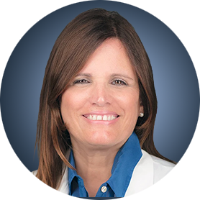
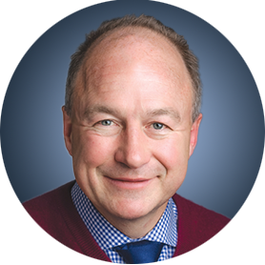

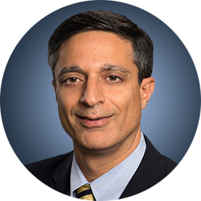
Faculty
Melissa Alsina, MD
Head, Myeloma Section
Bone Marrow Transplant and Cellular Immunotherapy Program
Moffitt Cancer Center
Tampa, Florida
Paul G Richardson, MD
Clinical Program Leader and Director of
Clinical Research
Jerome Lipper Multiple Myeloma Center
Dana-Farber Cancer Institute
RJ Corman Professor of Medicine
Harvard Medical School
Boston, Massachusetts
Hans Lee, MD
Director, Multiple Myeloma Research
Sarah Cannon Research Institute
Nashville, Tennessee
Moderator
Sagar Lonial, MD, FACP, FASCO
Chair and Professor
Department of Hematology and Medical Oncology
Anne and Bernard Gray Family Chair in Cancer
Chief Medical Officer
Winship Cancer Institute
Emory University School of Medicine
Atlanta, Georgia

Slide 3
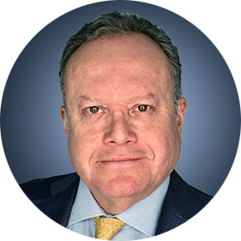
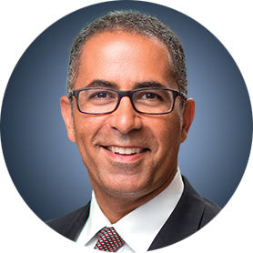
Contributing Clinical Investigators
Rafael Fonseca, MD
Chief Innovation Officer
Getz Family Professor of Cancer
Distinguished Mayo Investigator
Mayo Clinic in Arizona
Phoenix, Arizona
Joseph Mikhael, MD, MEd
Professor, Clinical Genomics and Therapeutics
Translational Genomics Research Institute (TGen)
City of Hope Cancer Center
Phoenix, Arizona

Slide 4
Dr Alsina — Disclosures
Faculty
Advisory Committees | Bristol Myers Squibb, Janssen Biotech Inc, Kite, A Gilead Company, Sanofi
Contracted Research | AstraZeneca Pharmaceuticals LP, Bristol Myers Squibb, Janssen Biotech Inc, Pfizer Inc
Data and Safety Monitoring Boards/Committees | Bristol Myers Squibb

Slide 5
Dr Lee — Disclosures
Faculty
Consulting Agreements (Paid to Institution) | AbbVie Inc, Alexion Pharmaceuticals, Allogene Therapeutics, AstraZeneca Pharmaceuticals LP, Bristol Myers Squibb, GSK, Janssen Biotech Inc, Legend Biotech, Medline, Pfizer Inc, Predicta Biosciences, Regeneron Pharmaceuticals Inc, Sanofi, Takeda Pharmaceuticals USA Inc
Consulting Agreements (Paid to Self) | Alexion Pharmaceuticals, Allogene Therapeutics, Bristol Myers Squibb, GSK, Janssen Biotech Inc, Menarini Group, Pfizer Inc, Regeneron Pharmaceuticals Inc, Sanofi, Takeda Pharmaceuticals USA Inc
Contracted Research | AbbVie Inc, Alexion Pharmaceuticals, Amgen Inc, AstraZeneca Pharmaceuticals LP, Bristol Myers Squibb, GSK, Janssen Biotech Inc, Menarini Group, Moderna, Regeneron Pharmaceuticals Inc, Takeda Pharmaceuticals USA Inc
Data and Safety Monitoring Boards/Committees | Allogene Therapeutics, Takeda Pharmaceuticals USA Inc

Slide 6
Dr Richardson — Disclosures
Faculty
Consulting Agreements | Bristol Myers Squibb, Celgene Corporation, GSK, Karyopharm Therapeutics, Oncopeptides, Regeneron Pharmaceuticals Inc, Sanofi
Contracted Research | Oncopeptides

Slide 7
Dr Lonial — Disclosures
Moderator
Advisory Committees and Consulting Agreements | AbbVie Inc, Amgen Inc, Bristol Myers Squibb, Genentech, a member of the Roche Group, GSK, Janssen Biotech Inc, Novartis, Pfizer Inc, Regeneron Pharmaceuticals Inc, Takeda Pharmaceuticals USA Inc
Boards of Directors | TG Therapeutics Inc
Contracted Research | Bristol Myers Squibb, Janssen Biotech Inc, Novartis, Takeda Pharmaceuticals USA Inc
Stock Options/Stock — Public Companies | TG Therapeutics Inc

Slide 8
Dr Fonseca — Disclosures
Contributing Clinical Investigators
Board of Directors | Antengene
Consulting Agreements | AbbVie Inc, Adaptive Biotechnologies Corporation, Amgen Inc, Apple, Bristol Myers Squibb, Celgene Corporation, GSK, Janssen Biotech Inc, Karyopharm Therapeutics, Pfizer Inc, RA Capital Management, Regeneron Pharmaceuticals Inc, Sanofi
Data and Safety Monitoring Boards/Committees | Bristol Myers Squibb
Patents (Through Institution) | Abbott
Scientific Advisory Boards | Caris Life Sciences
Stock Options/Stock — Public Companies | Antengene, Caris Life Sciences

Slide 9
Dr Mikhael — Disclosures
Contributing Clinical Investigators
Consulting Agreements | Bristol Myers Squibb, Janssen Biotech Inc, Menarini Group, Sanofi

Slide 10
Research To Practice President Neil Love, MD — Disclosures
Dr Love is president and CEO of Research To Practice. Research To Practice receives funds in the form of educational grants to develop CME activities from the following companies: Aadi Bioscience, AbbVie Inc, ADC Therapeutics, Agendia Inc, Alexion Pharmaceuticals, Amgen Inc, Array BioPharma Inc, a subsidiary of Pfizer Inc, Arvinas, Astellas, AstraZeneca Pharmaceuticals LP, Aveo Pharmaceuticals, Bayer HealthCare Pharmaceuticals, BeOne, Biotheranostics Inc, A Hologic Company, Black Diamond Therapeutics Inc, Blueprint Medicines, Boehringer Ingelheim Pharmaceuticals Inc, Bristol Myers Squibb, Celcuity, Clovis Oncology, Coherus BioSciences, Corcept Therapeutics Inc, CTI BioPharma, a Sobi Company, Daiichi Sankyo Inc, Eisai Inc, Elevation Oncology Inc, Exact Sciences Corporation, Exelixis Inc, Genentech, a member of the Roche Group, Genmab US Inc, Geron Corporation, Gilead Sciences Inc, GSK, Helsinn Therapeutics (US) Inc, ImmunoGen Inc, Incyte Corporation, Ipsen Biopharmaceuticals Inc, Jazz Pharmaceuticals Inc, Johnson & Johnson, Karyopharm Therapeutics, Kite, A Gilead Company, Kura Oncology, Legend Biotech, Lilly, MEI Pharma Inc, Merck, Mersana Therapeutics Inc, Mirati Therapeutics Inc, Mural Oncology Inc, Natera Inc, Novartis, Novartis Pharmaceuticals Corporation on behalf of Advanced Accelerator Applications, Novocure Inc, Nuvalent, Nuvation Bio Inc, Pfizer Inc, Pharmacyclics LLC, an AbbVie Company, Puma Biotechnology Inc, Regeneron Pharmaceuticals Inc, Revolution Medicines Inc, Rigel Pharmaceuticals Inc, R-Pharm US, Sanofi, Seagen Inc, Servier Pharmaceuticals LLC, SpringWorks Therapeutics Inc, Stemline Therapeutics Inc, Sumitomo Pharma America, Summit Therapeutics, Syndax Pharmaceuticals, Taiho Oncology Inc, Takeda Pharmaceuticals USA Inc, TerSera Therapeutics LLC, and Tesaro, A GSK Company.

Slide 11
Commercial Support
This activity is supported by educational grants from Bristol Myers Squibb, Genentech, a member of the Roche Group, and GSK.
Research To Practice CME Planning Committee Members,
Staff and Reviewers
Planners, scientific staff and independent reviewers for Research To Practice have no relevant financial relationships to disclose.

Slide 12
This educational activity contains discussion of
non-FDA-approved uses of agents and regimens. Please refer to official prescribing information for each product for approved indications.

Slide 13



Clinicians in the Meeting Room
Networked iPads are available.
Review Program Slides: Tap the Program Slides button to review speaker presentations and other program content.
Answer Survey Questions: Complete the pre- and postmeeting surveys. Survey questions will be discussed throughout the meeting.
Ask a Question: Tap Ask a Question to submit a challenging case or question for discussion. We will aim to address as many questions as possible during the program.
For assistance, please raise your hand. Devices will be collected at the conclusion of the activity.
Notes:
13

Slide 14

Clinicians Attending via Zoom
Review Program Slides: A link to the program slides will be posted in the chat room at the start of the program.
Answer Survey Questions: Complete the pre- and postmeeting surveys.
Ask a Question: Submit a challenging case or question for discussion using the Zoom chat room.
Get CME Credit: A credit link will be provided in the chat room at the conclusion of the program.
Notes:
14

Slide 15
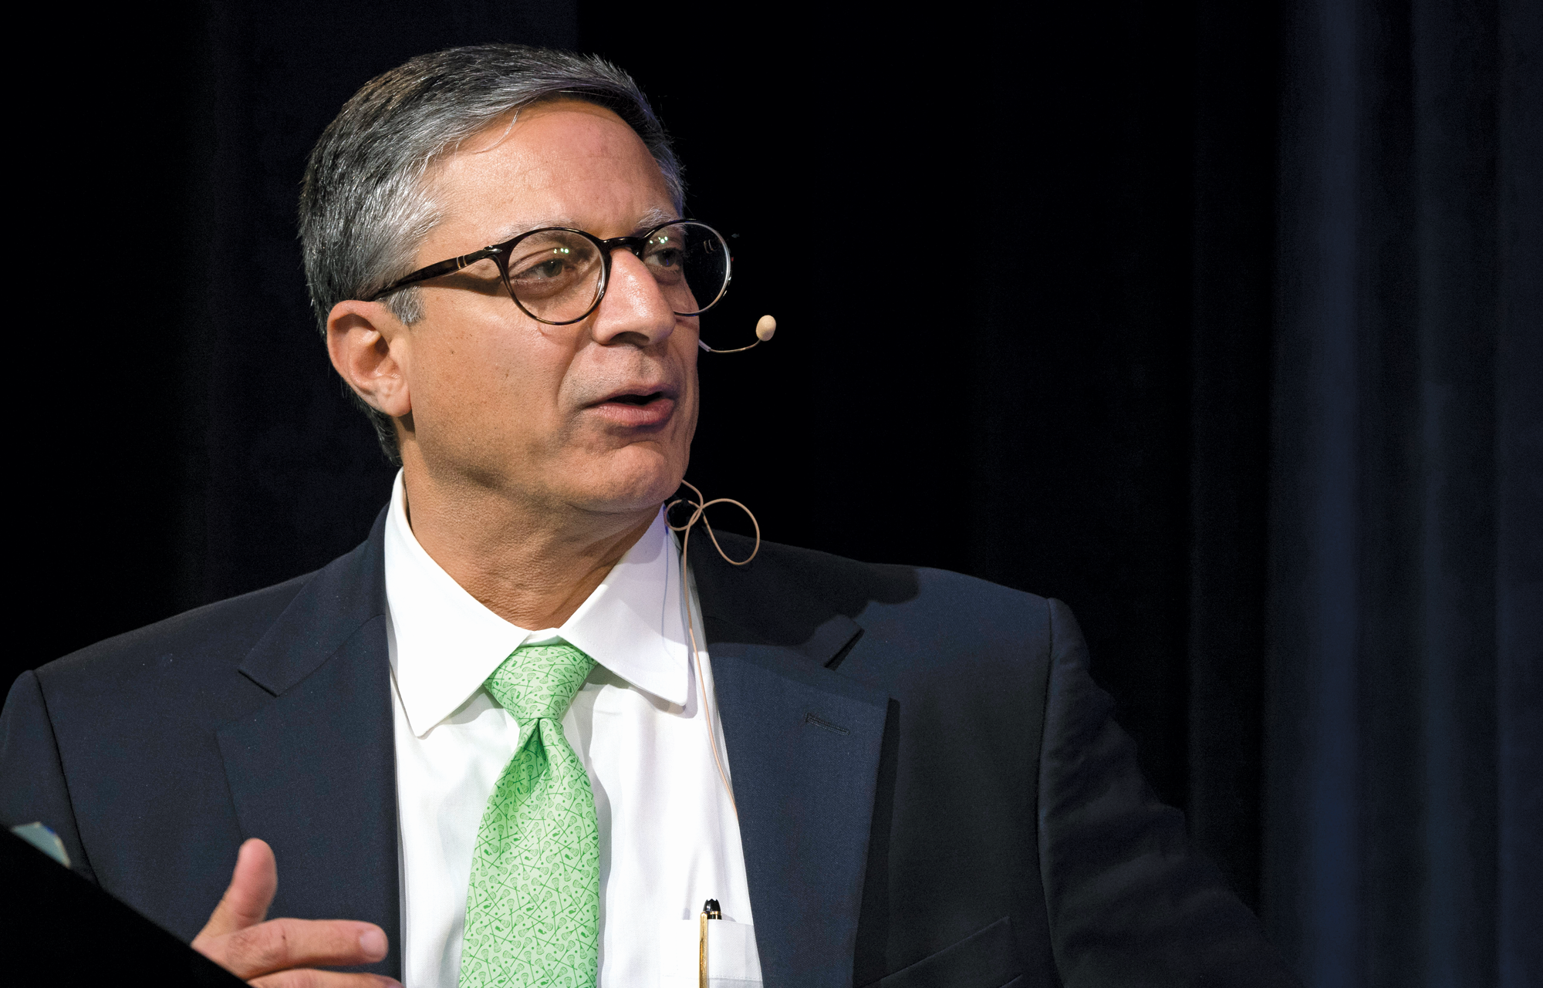
About the Enduring Program
The live meeting is being video
and audio recorded.
The proceedings from today will
be edited and developed into
an enduring web-based program.
An email will be sent to all attendees
when the activity is available.
To learn more about our education programs, visit our website, www.ResearchToPractice.com
Notes:
15
15

Slide 16
Consensus or Controversy? Documenting and Discussing Investigators’ Approaches to the
Management of Relapsed/Refractory Multiple Myeloma
Monday, June 1, 2026
7:00 PM – 9:00 PM CT (8:00 PM – 10:00 PM ET)
Faculty
Melissa Alsina, MD
Hans Lee, MD
Paul G Richardson, MD
Moderator
Sagar Lonial, MD, FACP, FASCO

Slide 17
Agenda
Module 1: Integrating Bispecific Antibodies into the Management of Relapsed/Refractory (R/R) Multiple Myeloma (MM) — Dr Lee
Module 2: Current Utility of Antibody-Drug Conjugates for MM — Dr Lonial
Module 3: Potential Role of Cereblon E3 Ligase Modulators in Therapy for MM — Dr Richardson
Module 4: Chimeric Antigen Receptor T-Cell Therapy for R/R MM — Dr Alsina

Slide 18
Agenda
Module 1: Integrating Bispecific Antibodies into the Management of Relapsed/Refractory (R/R) Multiple Myeloma (MM) — Dr Lee
Module 2: Current Utility of Antibody-Drug Conjugates for MM — Dr Lonial
Module 3: Potential Role of Cereblon E3 Ligase Modulators in Therapy for MM — Dr Richardson
Module 4: Chimeric Antigen Receptor T-Cell Therapy for R/R MM — Dr Alsina

Slide 19
Integrating Bispecific Antibodies into the Management of Relapsed/Refractory Multiple Myeloma
June 1, 2026
Hans Lee, MD
Director, Multiple Myeloma Research
Sarah Cannon Research Institute
Notes:
I. DIAGNOSIS, STAGING, AND PROGNOSIS
Chronic Lymphocytic Leukemia

Slide 20
BCMA-directed BsAbs for RRMM: Registrational trials
TRIAL
KEY ELIGIBILITY
COHORTS
THERAPY
PRIMARY ENDPOINT
ELRANATAMAB^{1–4}
MagnetisMM-3
Phase 2
MM refractory to ≥1 of each of the following: PI, IMiD, anti-CD38 mAb
BCMA-Naïve
Elranatamab
monotherapy
IMWG ORR
by BICR
BCMA-Exposed
(ADC and/or CAR T)
TECLISTAMAB^{5–10}
MajesTEC-1
Phase 2
MM with ≥3 prior LoT
including PI, IMiD, anti-CD38 mAb
BCMA-Naïve
Teclistamab
monotherapy
IMWG ORR
by IRC
BCMA-Exposed
(ADC and/or CAR T)
LINVOSELTAMAB¹¹
LINKER-MM1
Phase 1/2
MM with ≥3 prior LoT
including PI, IMiD, anti-CD38 mAb
BCMA-Naïve or BCMA-Exposed
(ADC only)
Linvoseltamab
monotherapy
IMWG ORR
by IRC*
Linvoseltamab is not approved by the EMA
*Primary endpoint for Phase 2 of trial.
ADC, antibody-drug conjugate; BCMA, B-cell maturation antigen; BICR, blinded independent committee review; BsAb, bispecific antibody; CAR T, chimeric antigen receptor T-cell; CD, cluster of differentiation; EMA, European Medicines Agency; IMiD, immunomodulatory drug; IMWG, International Myeloma Working Group; IRC, independent review committee; LoT, lines of therapy; mAb, monoclonal antibody; MM, multiple myeloma; ORR, overall response rate; PI, proteasome inhibitor.
1. Clinicaltrials.gov. https://clinicaltrials.gov/study/NCT04649359. Accessed 21 August 2024. 2. ELREXFIO™ (elranatamab-bcmm) [prescribing information]. New York, NY. Pfizer Inc; August 2023. 3. ELREXFIO® (elranatamab) Summary of Product Characteristics. Bruxelles Belgium: Pfizer Europe; 2024. 4. ELREXFIO® (elranatamab). Sao Paulo, Brazil: Pfizer Brazil; 2024. 5. Clinicaltrials.gov. https://clinicaltrials.gov/study/NCT04557098. Accessed 21 August 2024. 6. Moreau P et al. N Engl J Med. 2022;387:495–505. 7. TECVAYLI® (teclistamab-cqyv) [prescribing information]. Horsham, PA. Janssen Biotech, Inc; February 2024. 8. TECVAYLI® (teclistamab) Summary of Product Characteristics. Beerse Belgium: Janssen-Cilag International; 2024. 9. TECVAYLI™ (teclistamab) Sao Paulo, Brazil: Janssen-Cilag Farmacêutica Ltda; 2024. 10. Touzeau C et al. ASCO 2022. Abstract 8013 (poster presentation). 11. Bumma N et al. J Clin Oncol. 2024;42:2702–2712.
Content Courtesy of Noopur Raje, MD

Slide 21
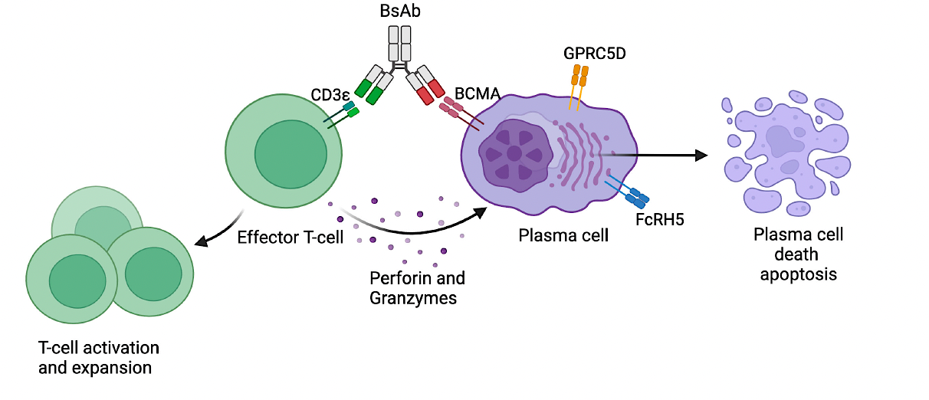
Bispecific Antibody Targets and Mechanism of Action
 | BCMA | GPRC5D | FcRH5
Expression | Plasma cells, plasmablasts | Plasma cells, hair follicles, eccrine glands, filiform papillae of tongue | B-cell lineage cells, including plasma cells
Biological significance | Survival/growth of plasma cells | Unclear | Unclear
Location | 16p13 | 12p13 | 1q21
Extracellular shedding? | Yes | No | Yes
Rees M, et al. Front Immunol. 2024;15:1424925; Yu B, et al. J Hematol Oncol. 2020;13:125; Rodrigueze-Otero P, et al. Blood Cancer J. 2024;14:24; Li J, et al. Cancer Cell. 2017;31:383-395; Ise T, et al. Leukemia. 2007;21:169-174.

Slide 22
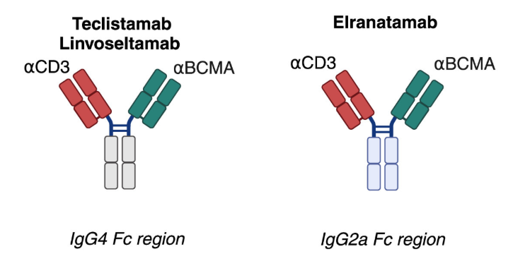
BCMA Bispecific T-Cell Antibodies
Content Courtesy of Noopur Raje, MD
Waldschmidt et al. Clin Lymphoma Myeloma Leuk 2025

Slide 23
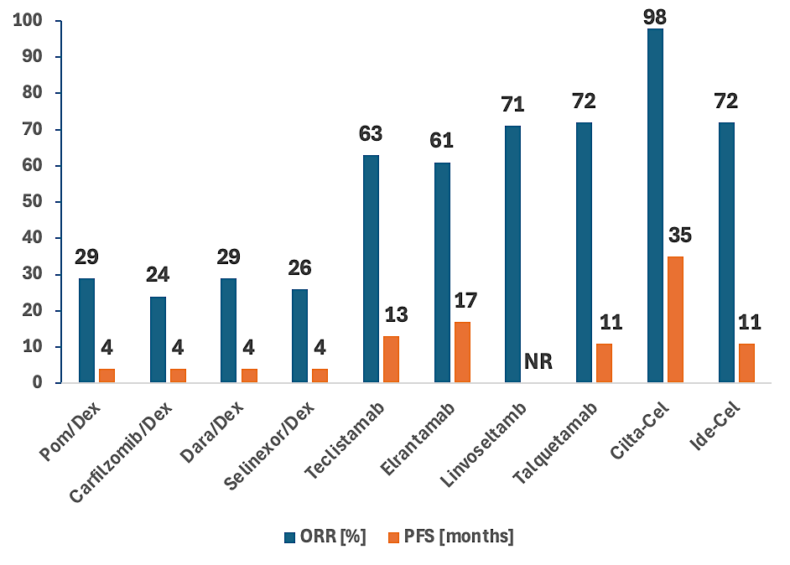
Overall Response Rate (ORR) and Progression Free Survival (PFS) of Recently Approved Drugs in Relapsed/Refractory Myeloma
Moreau P, et al. N Engl J Med. 2022;387:495-505; Lesokhin AM, et al. Nat Med. 2023;29:2259-2267; Bumma N, et al. J Clin Oncol. 2024;42:2702-2712; Chari A, et al. N Engl J Med. 2022;12:e269-e281.

Slide 24
BCMA Bispecific T-Cell Antibodies Clinical Data
Drug | N | Route/Schedule | ORR at RP2D or Higher Doses Tested to Date | CRS | Comments
Teclistamab FDA/EC approved, 2022 | 165 | SC q week, then q2 weeks if ≥CR for 6 months | 63%, 59% ≥VGPR, N = 165 | All grade (72%), grade 2 (21%), grade 3–4 (1%) | Median PFS 11.4 months Median DOR 24 months
Elranatamab FDA/EC approved, 2023 | 123 | SC q week, then q2 weeks after 6 cycles with ≥PR for ≥2 months, then q4 weeks starting week 49 | 61%, 56% ≥VGPR (76 mg SC, N = 123) | All grade (56%), grade 2 (14%); grade 3–4 (0%) | Median PFS: 17.2 months 18-month DOR: 68.8%
Linvoseltamab FDA/EC approved, 2025 | 117 | IV q week, then q2 weeks starting week 16, then q4 weeks starting week 24 if ≥VGPR | 71%, 63% ≥VGPR (200-mg cohort, N = 117) | All grade (46%), grade 2 (10%), grade 3 (1%), (200-mg cohort) | Median DOR: 29.4 months 12-month median PFS: 70%
Ententamig (ABBV-383) (in clinical development) | 75 | IV q3 (40 mg) or q4 (60 mg) weeks | 66%, 54% ≥VGPR (N = 146) | All grade (30%), grade 3–4 (0%) | 12-month PFS 55%; 2 BCMA binding domains with attenuated CD3 binding domain
Garfall A, et al. ASCO 2024. Abstract 7540; Bumma N, et al. J Clin Oncol. 2024;42:2702-2712; Lesokhin A, et al. Nat Med. 2023;29:2259-2267; Tomasson M, et al. ASH 2023. Abstract 3385; Baljevic M, et al. ASCO 2025. Abstract 7527.

Slide 25
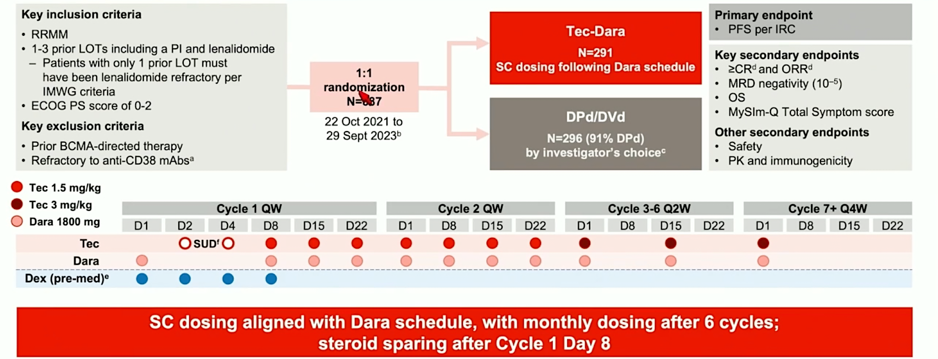
MajesTEC-3: Teclistamab + Dara vs. SOC in RRMM
1:1
randomization
N=587
Mateos et al, Blood 2025; 146 (Supplement 2): 94.

Slide 26
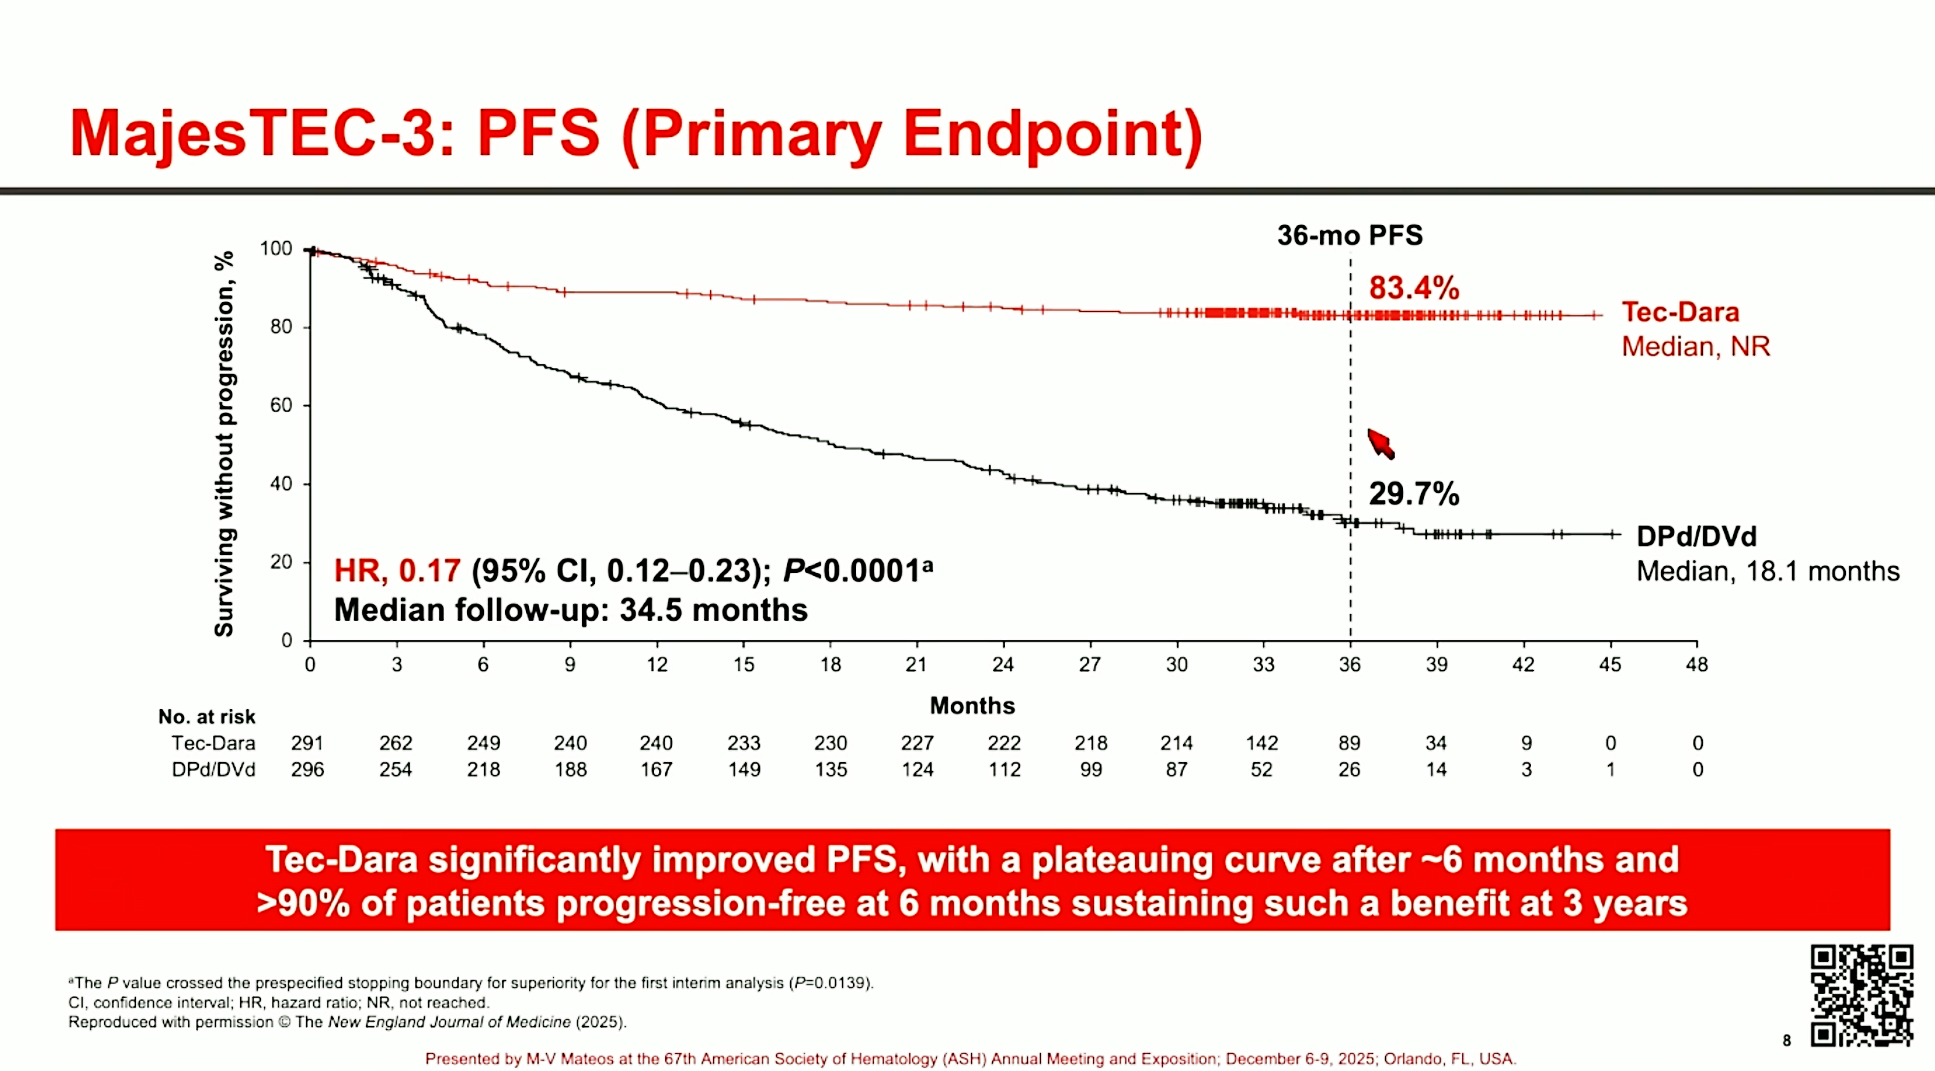
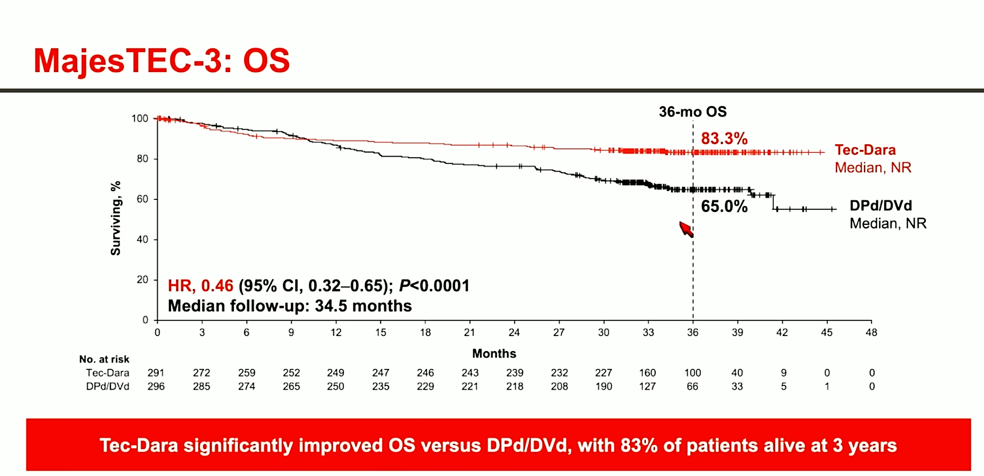
MajesTEC-3: Teclistamab + Daratumumab vs. Standard Therapies (1-3 prior lines of therapy)
Teclistamab + Daratumumab combination significant longer survival compared to conventional therapies!
FDA Approved on March 5, 2026
Ho et al, ASH 2025

Slide 27
MajesTEC-9: Teclistamab vs Standard Therapies
(1-3 prior lines of therapy)
Teclistamab (n=296)
Relapsed/Refractory Myeloma
1-3 lines of therapy
Anti-CD38 & lenalidomide exposed
R
Pomalidomide/Bortezomib/Dex OR
Carfilzomib/Dex (n=297)
Len refractory: 80%
anti-CD38 refractory: 85%
Safety (Tec vs. SOC)
Gr≥3 TEAEs: 85% vs 76%
Gr≥3 Infections: 42% vs 29%
Tec arm:
CRS: 66% (G1/2 48.8% and 16.5%)
ICANS: 4%
Efficacy Tec vs. SOC
≥ CR rate: 65.9% vs 16.8%; P<0.0001
Median PFS: NR vs 8.2 months; HR 0.29
18-month PFS: 69.8% vs 26.9%
Significant OS benefit of Tec vs SOC; HR 0.60
Mina et al. ASCO Annual Meeting. 2026.

Slide 28
MagnetisMM-5: Elranatamab vs. Dara/Pom/Dex
(≥ 1 line of prior therapy)
PRESS RELEASE on April 29, 2026
Primary endpoint met at the interim analysis in MagnetisMM-5 trial with significant improvement in progression-free survival with elranatamab monotherapy
Trial remains ongoing to assess overall survival (key secondary endpoint), which was not yet mature at the time of interim analysis
https://www.pfizer.com/news/press-release/press-release-detail/pfizers-elrexfio-significantly-improves-progression-free

Slide 29
BCMA Bispecific Step-up Dosing Comparison
 | Teclistamab | Elranatamab | Linvoseltamab
Step-up dosing (SUD) schedule | Day 1: 0.06 mg/kg Day 4: 0.3 mg/kg Day 7: 1.5 mg/kg | Day 1: 12 mg Day 4: 32 mg Day 8: 76 mg | Day 1: 5 mg Day 8: 25 mg Day 15: 200 mg
Recommended Hospitalization | 48-hours after each SUD1, SUD2, SUD3 | 48 hours after SUD1 24 hours after SUD2 | 24 hours after SUD1 and SUD2
Subsequent dosing | 1.5 mg/kg one week after first treatment dose and weekly thereafter | 76 mg one week after first treatment dose and weekly through week 24; week 25 and every 2 weeks through week 48, week 49 and every 4 weeks thereafter | 200 mg one week after day 15 and once weekly from week 4 to 13 for 10 doses
Hospitalization requirements can limit access to bispecifics!
teclistamab US PI; elranatamab US PI; linvoseltamab US PI

Slide 30
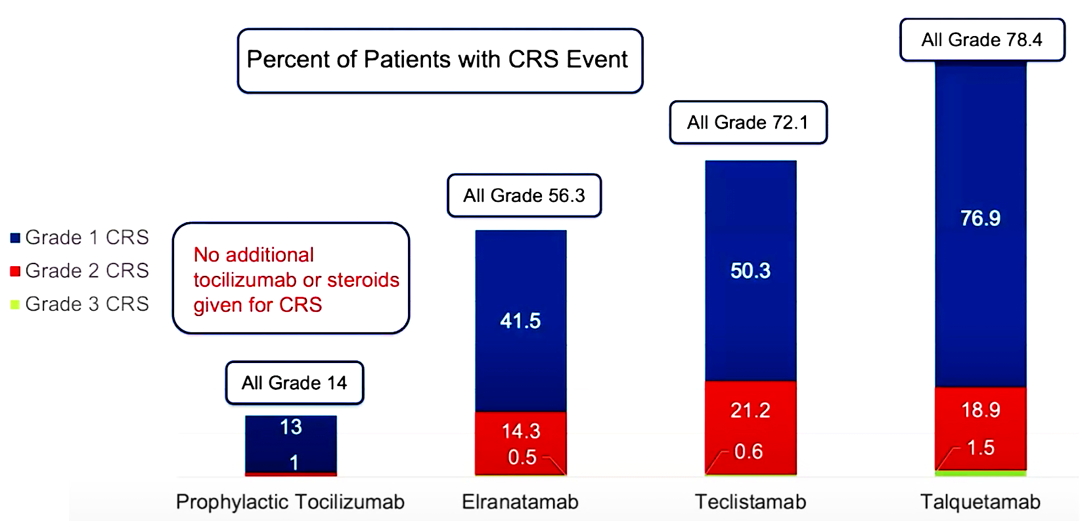
Tocilizumab Prophylaxis with
Bispecific Step-up Dosing
APRIL 2025: Prophylactic tocilizumab now listed on NCCN guidelines as consideration
prior to first dose of bispecific antibody
Prophylactic tocilizumab significantly reduces rates of CRS
Kowalski A. et al., ASH 2024, Abstract 932; Kowalski A et al, Blood Advances, 2025

Slide 31
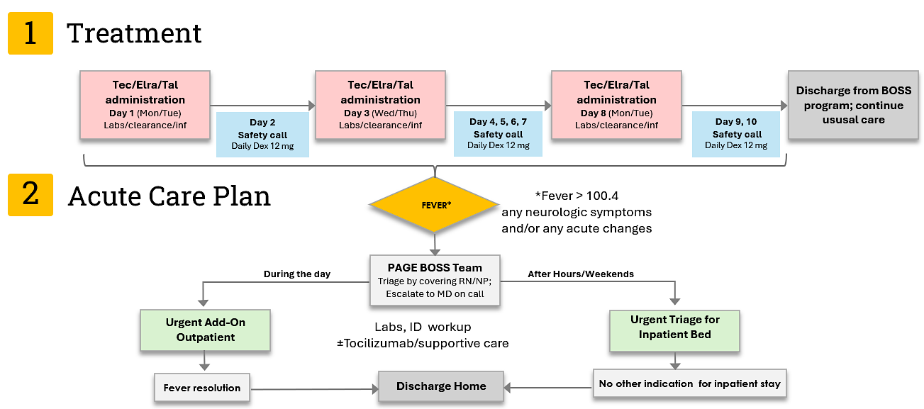
BISPECIFIC OUTPATIENT STEP-UP DOSING WITH PROPHYLACTIC DEXAMETHASONE:
THE BOSS PROGRAM EXPERIENCE at MGH
Content Courtesy of Noopur Raje, MD
Cirstea et al IMS 2025

Slide 32
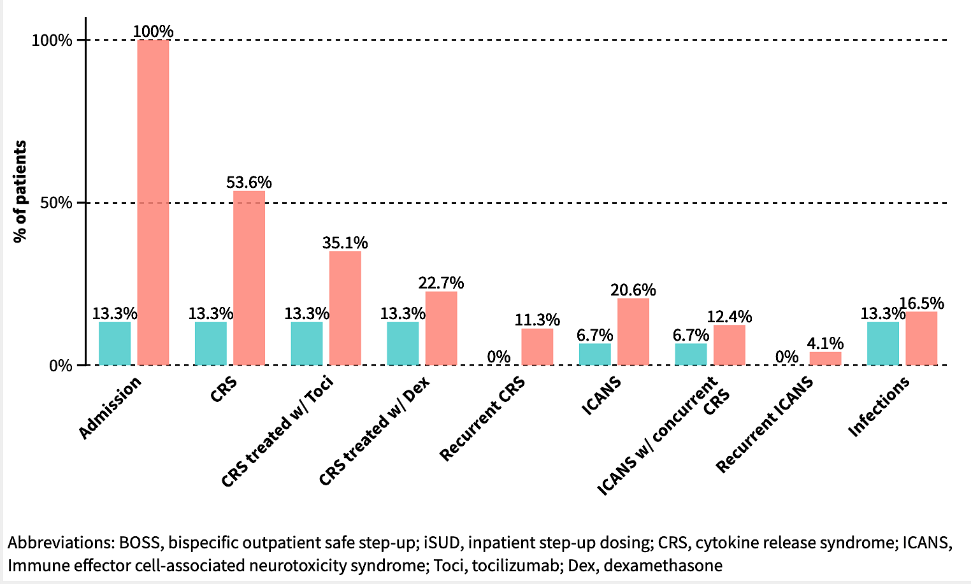
Toxicities and Management Among BOSS and iSUD Cohorts
Figure 1: Grouped column chart illustrating percentage of patients experiencing CRS, ICANS, recurrent events, requiring admission or treatment with tocilizumab or dexamethasone across BOSS (n=15) and iSUD (n=97) cohorts
Content Courtesy of Noopur Raje, MD

Slide 33
Outcomes With Bispecific Antibodies
After Prior BCMA-Directed Therapy
Teclistamab Best ORR With and Without Exposure to ≥1 Lines of BCMA Treatment
Pooled Analysis of Elranatamab Efficacy After Prior BCMA Therapy
100
100
80
80
60
60
40
40
20
20
0
0
mDoR, mo:
NR
17.1
13.6
NE
Moreau. NEJM. 2022;387:495. Dima. ASH 2023. Abstr 91.
Lesokhin. Nat Med. 2023;29;2259-2267. Nooka. ASCO 2023. Abstr 8008.
Content Courtesy of Noopur Raje, MD

Slide 34
Non-BCMA Bispecific T-Cell Antibodies in Clinical Development
Drug | N | Route/Schedule | ORR at RP2D or Higher Doses Tested to Date | CRS | Comments
Talquetamab (GPRC5D × CD3) FDA approved August 2023 | 74 | SC q week SC q2 weeks | 74%, 59% ≥VGPR (0.4 mg/kg q week, N = 143) 73%, 57% ≥VGPR (0.8 mg/kg q2 weeks, N = 145) | 79% all grade, 2% grade 3–4 (0.4 mg/kg q week, N = 143) 72% all grade, 1% grade 3–4 (0.8 mg//kg q2 weeks, N = 145) | Other unique AEs: dysgeusia, skin exfoliation, nail disorders
Cevostamab (FcRH5 × CD3) | 167 | IV q3 weeks × 17 cycles (fixed duration) | 43% (160-mg target dose) No prior BCMA: 61% Prior BCMA: 30% | All grade (74%) grade 3–4 (2%) | 57% prior BCMA 24% prior bispecific
Chari A, et al. N Engl J Med. 2019;381:727-738; Chari A, et al. ASH 2022; Richter et al. ASH 2024.

Slide 35
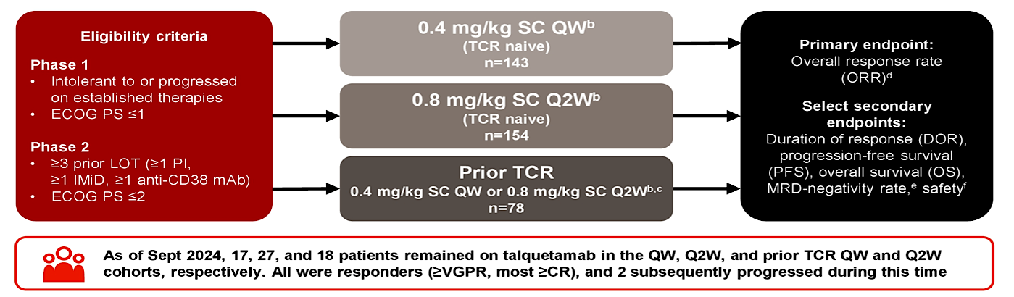
Phase I/II MonumenTAL-1 Study: Design
Content Courtesy of Noopur Raje, MD
Rasche L et al. ASCO 2025

Slide 36
Talquetamab (MonumenTAL-1) – Efficacy
0.4 mg/kg
SC QW
0.8 mg/kg
SC QOW
71% received CAR T therapy, 35% received a BsAb, and 6% received both
Chari A, et al. ASH 2022; Chari A, et al. N Engl J Med. 2019;381:727-738.

Slide 37
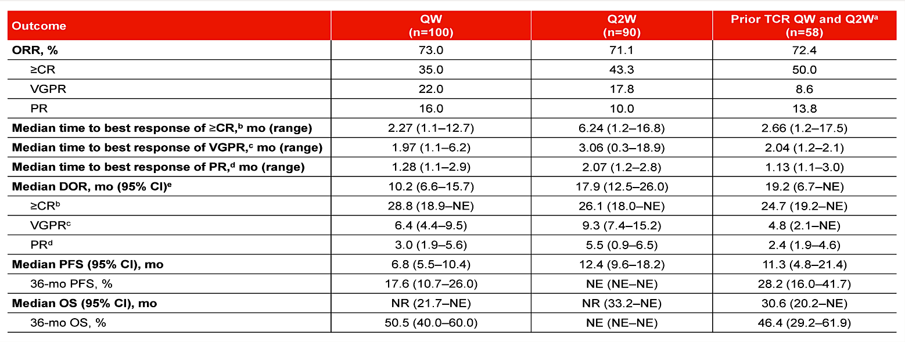
Phase I/II MonumenTAL-1 Study: Additional Efficacy Outcomes*
Data reported from phase 2 only*
Rasche L et al. ASCO 2025
Content Courtesy of Noopur Raje, MD

Slide 38
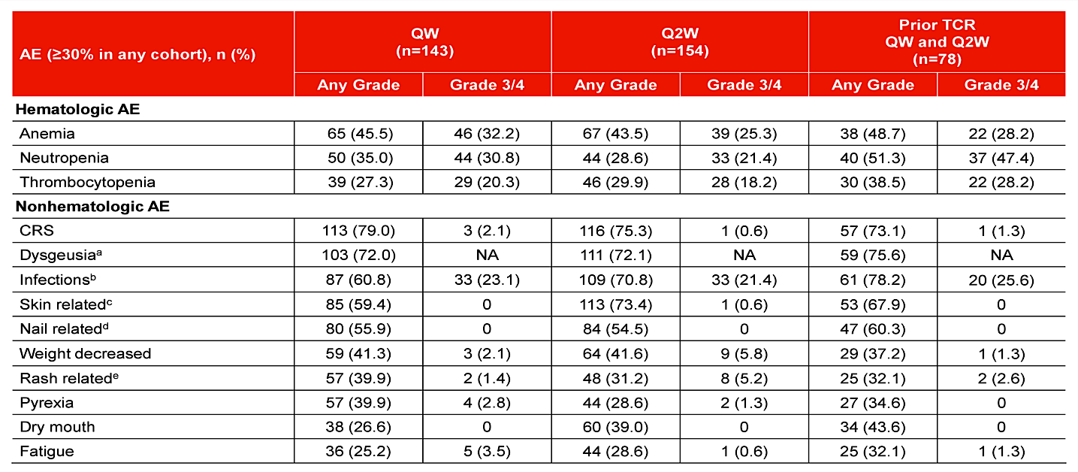
Phase I/II MonumenTAL-1 Study: AEs
Content Courtesy of Noopur Raje, MD
Rasche L et al. ASCO 2025

Slide 39
MONUMENTAL-3: Tal + Dara + Pom vs. Tal + Dara vs. Dara + Pom + Dex
Talquetamab + Daratumumab + Pomalidomide
(N=287)
Relapsed/Refractory Myeloma
≥ 1 line of prior therapy
lenalidomide and proteasome inhibitor exposed
R
Talquetamab + Daratumumab
(N=287)
Len refractory: 85%
anti-CD38 exposed: 12%
Daratumumab + Pomalidomide + Dexamethasone
(N=290)
Efficacy: Tal/Dara/Pom vs. Tal/Dara vs. Dara/Pom/Dex
MRD neg ≥ CR rate: 52.3% vs. 46.3% vs. 15.9%
Significant PFS benefit of Tal/Dara/Pom and Tal/Dara vs Dara/Pom/Dex; HRs 0.28 and 0.33, respectively
24-month PFS: 81.3% vs 77.6% vs. 51.2%.
Voorhees et al. EHA. 2026.

Slide 40
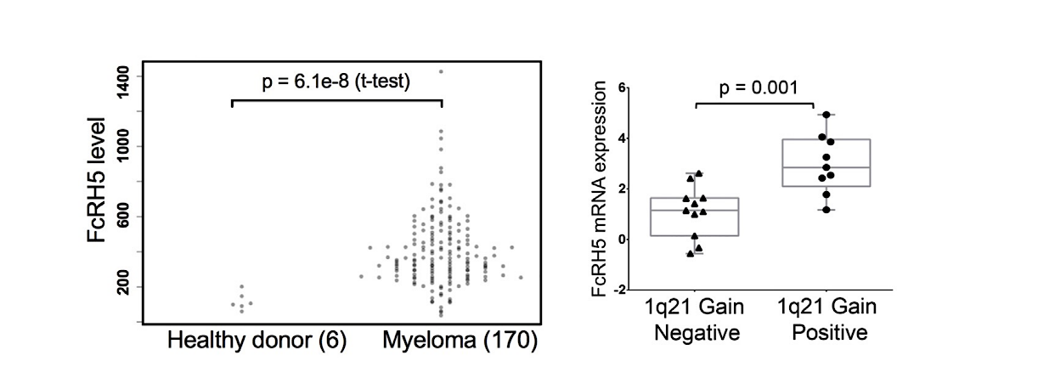
FcRH5 as a Target in Multiple Myeloma
Fc receptor-homolog 5 (FcRH5) located in the chromosomal breakpoint in 1q21
Increased and near exclusive expression on B cells and plasma cells
Increased expression in +1q21 multiple myeloma
Li et al, Cancer Cell, 2017

Slide 41
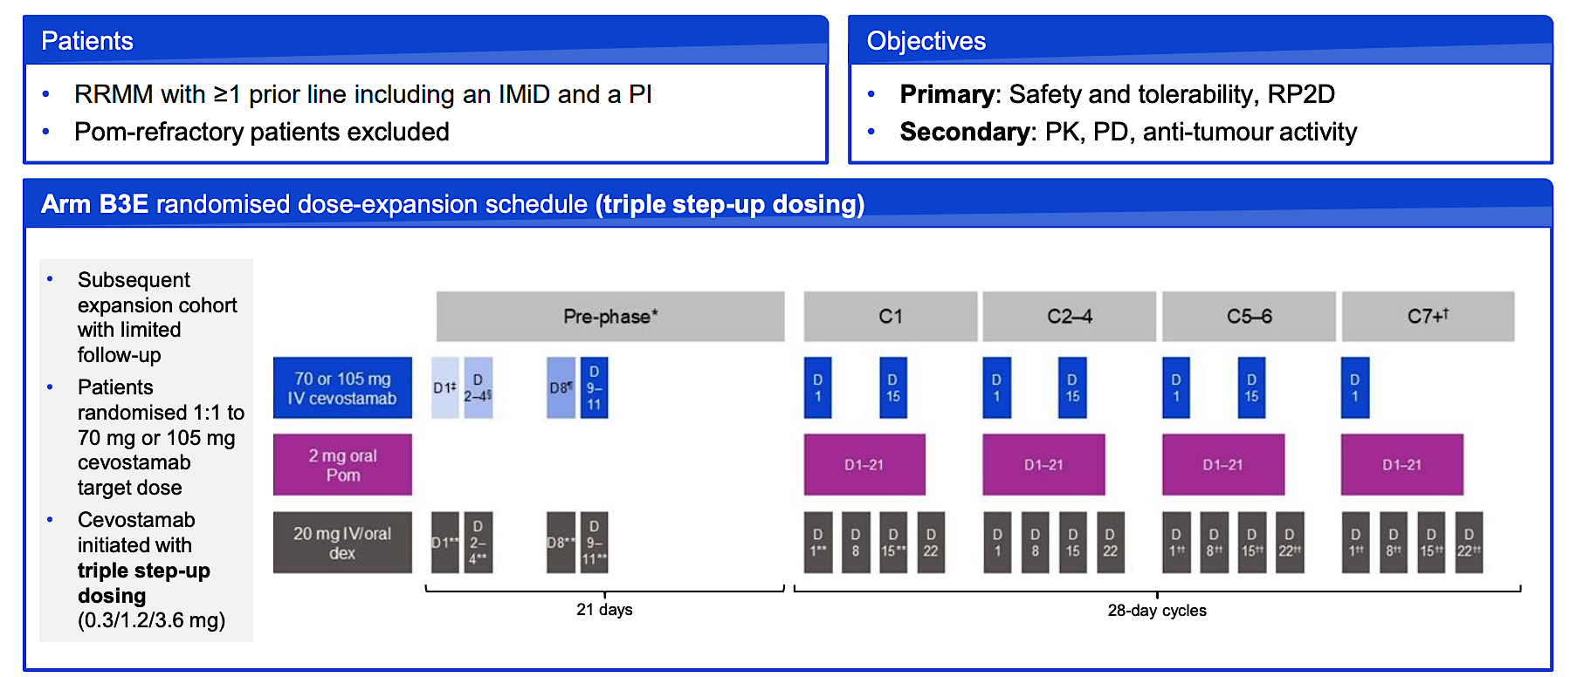
CAMMA 1: Randomized dose-expansion of cevostamab, pomalidomide, and dexamethasone
Mian et al, IMS 2025

Slide 42
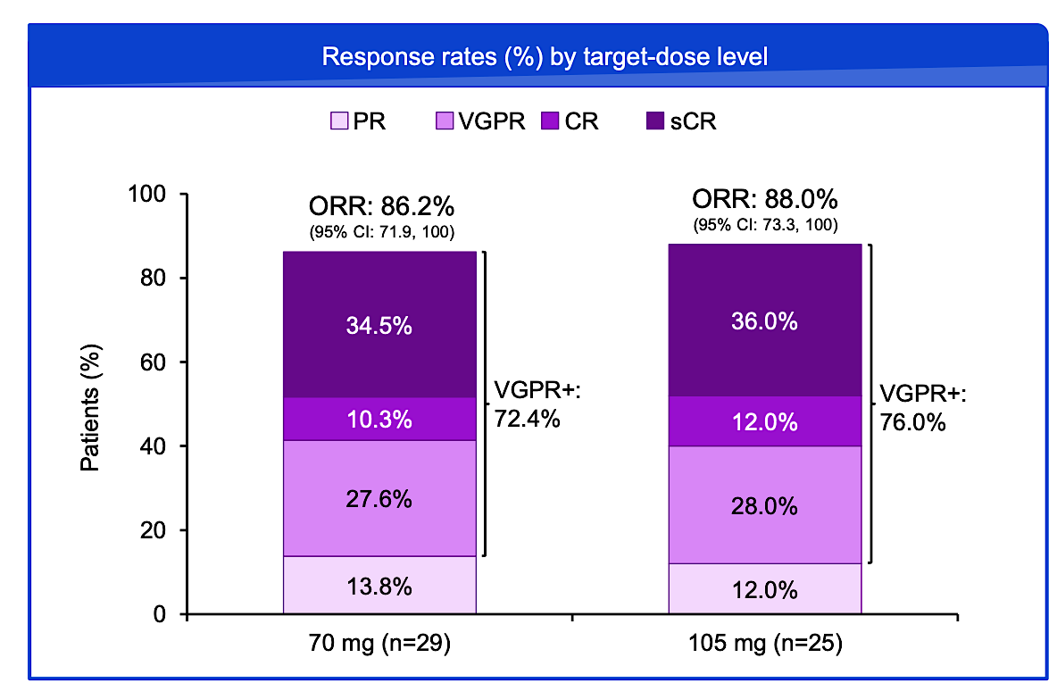
CAMMA 1: Randomized dose-expansion of cevostamab, pomalidomide, and dexamethasone
Mian et al, IMS 2025

Slide 43
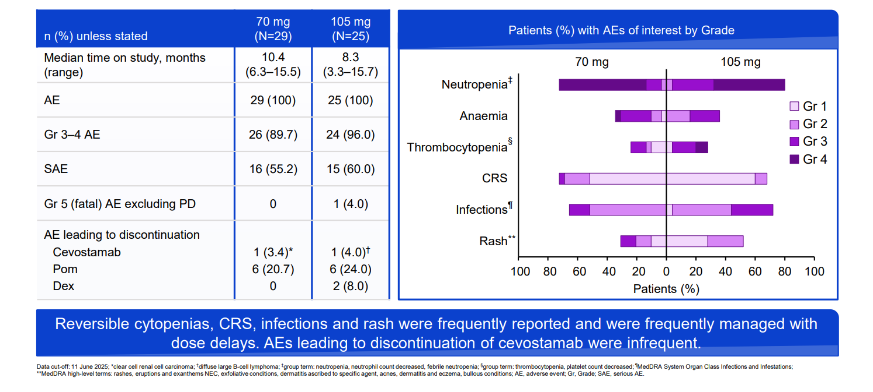
CAMMA 1: Safety summary by target dose level
Mian et al, IMS 2025

Slide 44
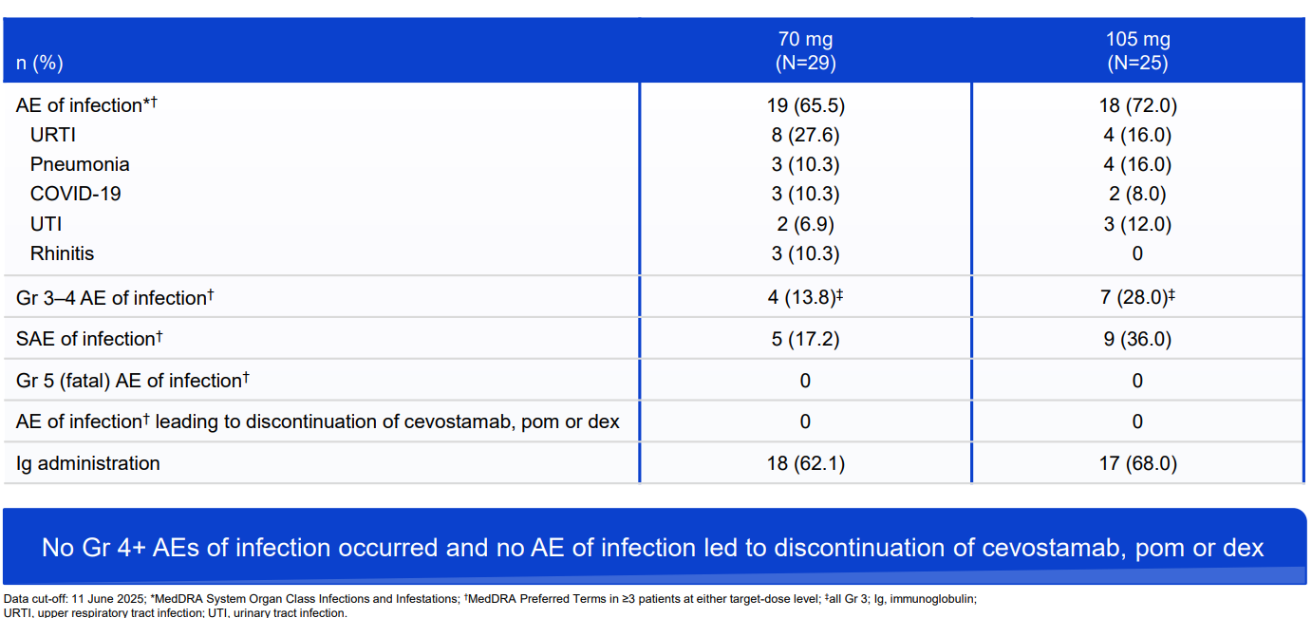
CAMMA 1: Infection summary by target dose level
Mian et al, IMS 2025

Slide 45
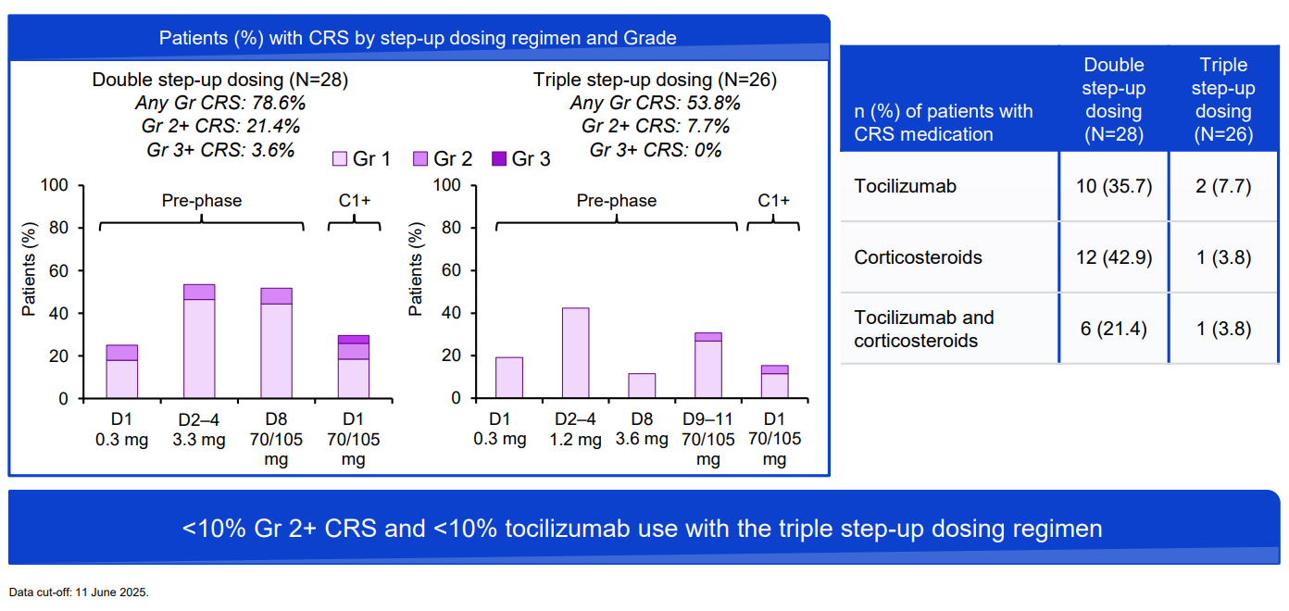
CAMMA 1: CRS by step-up dosing regimen
Mian et al, IMS 2025

Slide 46
CAMMA 1: Randomized dose-expansion of cevostamab, pomalidomide, and dexamethasone
Randomized Phase 3 ”CEVOLUTION” study to start in 2026 (NCT07555938)
RRMM with 1-3 prior lines of therapy and prior anti-CD38 & lenalidomide exposure
Cevostamab, pomalidomide, dexamethasone vs. SOC investigator’s choice (dara/pom/dex, elo/pom/dex or carfilzomib/dex)
Primary end points: MRD neg CR at 9 months and PFS
Mian et al, IMS 2025

Slide 47
Myeloma Bispecific Antibody Summary
  Bispecific antibodies represent a highly effective accessible “off-the-shelf” approach for the treatment of relapsed/refractory myeloma
  Multiple clinically validated targets (BCMA, GPRC5D, FCRH5)
  Randomized phase 3 studies reported to-date with BCMA and GPRC5D bispecific antibodies showing unprecedented results in early relapsed/refractory myeloma (≥ 1 line of prior therapy).
  Side effect profile manageable so that most patients can receive them
  Will form backbone of treatments across the myeloma disease spectrum for the foreseeable future

Slide 48
Regulatory and reimbursement issues aside, which next line of therapy would you most likely recommend for an 80-year-old patient with standard-risk MM who received initial treatment with Rd/daratumumab and experienced disease progression after 5 years of maintenance therapy?
Teclistamab/daratumumab
Teclistamab
Teclistamab
Belantamab mafotodin/bortezomib/dexamethasone
Elranatamab
Teclistamab

Slide 49
Regulatory and reimbursement issues aside, which next line of therapy would you most likely recommend for an 80-year-old patient with high-risk (del[17p]) MM who received initial treatment with Rd/daratumumab and experienced disease progression after 3 years of maintenance therapy?
Ciltacabtagene autoleucel
Ciltacabtagene autoleucel
Teclistamab/daratumumab
Belantamab mafotodin/bortezomib/dexamethasone
Elranatamab
Ciltacabtagene autoleucel

Slide 50
In general, how would you sequence a BCMA-targeted bispecific antibody and talquetamab for a patient with R/R MM who had experienced disease progression after BCMA-targeted CAR T-cell therapy?
BCMA-targeted bispecific antibody → talquetamab (depending on DOR)
DOR >12 months: BCMA-targeted bispecific antibody → talquetamab;
DOR <12 months talquetamab → BCMA-targeted bispecific antibody
Talquetamab → BCMA-targeted bispecific antibody
Talquetamab → BCMA-targeted bispecific antibody
Talquetamab → BCMA-targeted bispecific antibody
Talquetamab → BCMA-targeted bispecific antibody
DOR = duration of response to BCMA-targeted CAR T-cell therapy

Slide 51
In general, how would you sequence a BCMA-targeted bispecific antibody and talquetamab for a patient with R/R MM who had not previously received BCMA-targeted CAR T-cell therapy?
BCMA-targeted bispecific antibody → talquetamab
BCMA-targeted bispecific antibody → talquetamab
BCMA-targeted bispecific antibody → talquetamab
BCMA-targeted bispecific antibody → talquetamab
BCMA-targeted bispecific antibody → talquetamab
BCMA-targeted bispecific antibody → talquetamab

Slide 52
Based on early evidence, how would you indirectly compare the global efficacy of the FcRH5-directed bispecific antibody cevostamab to that of BCMA-targeted bispecific antibodies and talquetamab for R/R MM?
BCMA-targeted
bispecific antibodies
Talquetamab
Not enough data are available to tell
Not enough data are available to tell
Efficacy is about the same
Efficacy is about the same
Not enough data are available to tell
Not enough data are available to tell
Not enough data are available to tell
Not enough data are available to tell
BCMA-targeted bispecific antibodies are more efficacious
Talquetamab is more efficacious
BCMA-targeted bispecific antibodies are more efficacious
Talquetamab is more efficacious

Slide 53
Based on early evidence, how would you indirectly compare the global and tolerability of cevostamab to that of BCMA-targeted bispecific antibodies and talquetamab for R/R MM?
BCMA-targeted
bispecific antibodies
Talquetamab
Not enough data are available to tell
Not enough data are available to tell
Cevostamab is more tolerable
Cevostamab is more tolerable
Tolerability is about the same
Cevostamab is more tolerable
Cevostamab is more tolerable
Cevostamab is more tolerable
Tolerability is about the same
Tolerability is about the same
Tolerability is about the same
Cevostamab is more tolerable

Slide 54
If cevostamab were to become available, how would you most likely sequence it relative to BCMA- and GPRC5D-targeted bispecific antibodies?
BCMA bispecific → GPRC5D bispecific → cevostomab
BCMA bispecific → cevostomab → GPRC5D bispecific
BCMA bispecific → cevostomab → GPRC5D bispecific
BCMA bispecific → GPRC5D bispecific → cevostomab
BCMA bispecific → GPRC5D bispecific → cevostomab
BCMA bispecific → cevostomab → GPRC5D bispecific

Slide 55
Do you believe that bispecific antibodies can be safely and effectively administered in community cancer centers?
Would you recommend preemptive tocilizumab before administering a bispecific antibody to a patient with R/R MM?
Administered in community setting?
Preemptive tocilizumab?
Yes
Yes, for all patients
Yes
Yes, for all patients
Yes
Yes, for all patients
No
Yes, for all patients
Yes
Yes, for select patients
Yes
Yes, for all patients

Slide 56
Agenda
Module 1: Integrating Bispecific Antibodies into the Management of Relapsed/Refractory (R/R) Multiple Myeloma (MM) — Dr Lee
Module 2: Current Utility of Antibody-Drug Conjugates for MM — Dr Lonial
Module 3: Potential Role of Cereblon E3 Ligase Modulators in Therapy for MM — Dr Richardson
Module 4: Chimeric Antigen Receptor T-Cell Therapy for R/R MM — Dr Alsina

Slide 57

BCMA ADC in MM
Sagar Lonial, MD
Professor and Chair
Department of Hematology and Medical Oncology
Anne and Bernard Gray Professor in Cancer
Chief Medical Officer, Winship Cancer Institute
Emory University School of Medicine

Slide 58
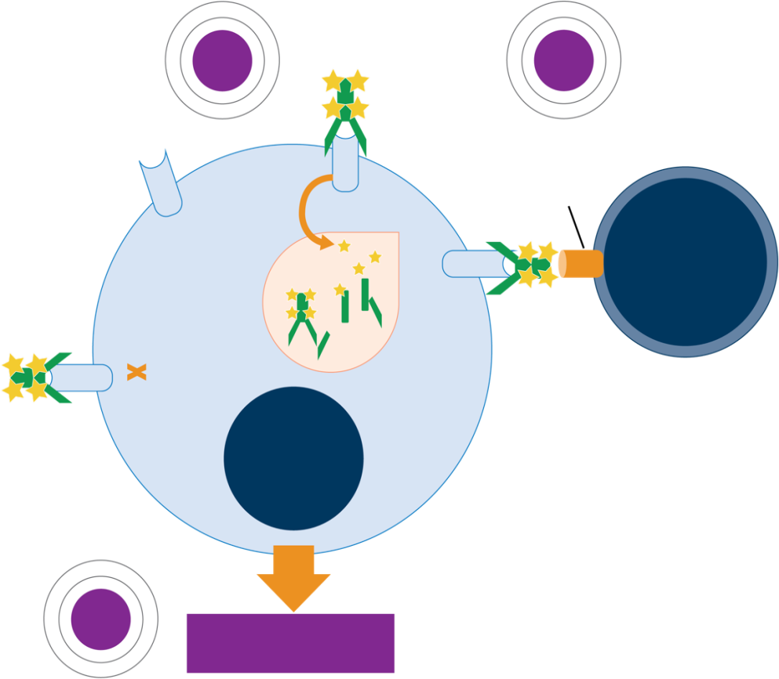

Belamaf Is an Immunoconjugate Targeting
BCMA With a Multimodal MOA¹
ADC
BCMA-targeting antibody conjugated with a cytotoxic payload (MMAF)
Payload induced direct cell death
Antibody engineered to have ADCC, while MMAF induces immunogenic cell death, eliciting an immune response
An “off-the-shelf” BCMA option useful for patients unable to receive CAR-T
(eg, due to frailty or mobility issues)
1
2
ADCC/ADCP
Fc
receptor
BCMA
Lysosome
BCMA
Effector
cell
BCMA
BCMA
Malignant
plasma
cell
October 2025: FDA-approved in
combination with Vd for patients
who have received ≥2 prior LOT²
3
Markers of ICD

Slide 59
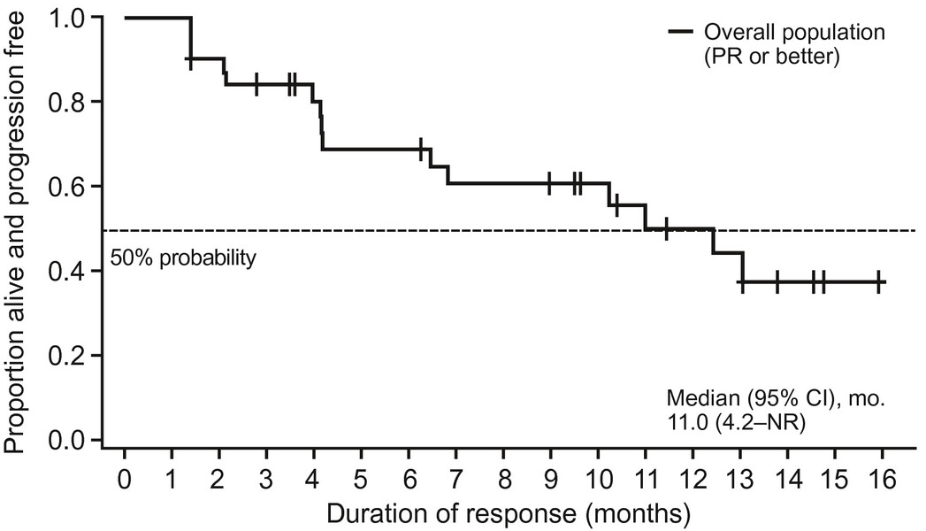
Phase II DREAMM-2: Response and DoR
13 mo Follow-up
ORR: 32%
n = 2
n = 5
n = 11
Patients (%)
n = 13
Lonial S et al. Cancer. 2021 Nov 15;127(22):4198-4212.

Slide 60
In Current Guidelines, BCMA ADC Therapy Is Recommended for Early-Relapse MM^{1,a}
Therapy for Previously Treated RRMM After One to Three Prior Therapies
Preferred
CAR-T cell therapy After one prior LOT, including an IMiD and a PI, and refractory to lenalidomide Ciltacabtagene autoleucel (category 1) After two prior LOT, including an IMiD, a PI, and an anti-CD38 mAb Idecabtagene vicleucel (category 1)
Other Recommended
After two prior LOT, including an IMiD and a PI Belantamab mafodotin-blmf/Bortezomib/Dexamethasone (category 1)
Supported by DREAMM-7

Slide 61
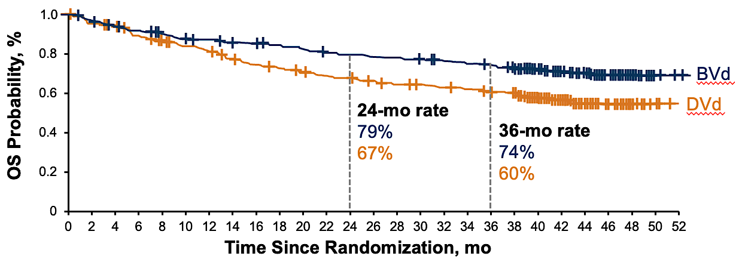
DREAMM-7 Showed Greater and Sustained PFS and OS Benefit
With Belamaf Plus Vd Compared With DVd¹
OS Probability
Median Follow-Up: 39.4 mo | BVd (N = 243) | DVd (N = 251)
Median PFS, mo | 36.6 | 13.4
OS at 24 mo, % | 79 | 67
OS at 36 mo, % | 74 | 60
Median OS, mo | NR, HR = 0.58; P = .0002
ORR, % | 83 | 71
≥CR, % | 36 | 18

Slide 62
Additional Outcomes Show Maintained Treatment Benefit
After BVd And Encouraging MRD-Negativity Rates
PFS2 showed maintained treatment benefit with BVd vs DVd following subsequent antimyeloma therapy¹
BVd showed greater overall MRD negativity rates compared with DVd²
 | Median PFS2, mo | Events, n (%)
BVd | NR (45.6-NR) | 93 (38)
DVd | 33.4 (26.7-44.9) | 126 (50)
HR for disease progression or death = 0.59 (95% CI, 0.45-0.77)
Responses, % (n/N) | BVd (N = 243) | DVd (N = 251)
≥CR | 36 (87/243) | 18 (44/251)
≥CR and MRD negativity (10⁻⁵) | 70 (61/87) | 59 (26/44)
≥CR and MRD negativity (10⁻⁶) | 45 (39/87) | 23 (10/44)
Sustained ≥CR MRD negativity for ≥12 mo | 57 (35/61) | 42 (11/26)
+
+
+
+
+
+
+
+
+
+
+
+
+
+
1.0
+
+
+
+
+
+
+
+
+
+
+
+
+
+
+
+
+
+
+
+
+
+
+
+
+
+
+
+
+
+
+
+
+
+
+
+
+
+
+
+
+
+
+
+
BVd
+
+
+
+
+
+
+
+
+
+
+
+
+
+
+
+
+
+
+
+
+
+
+
+
+
+
+
+
+
+
+
+
+
+
+
+
+
+
+
+
+
+
+
+
PFS2 Probability
+
+
+
+
+
+
+
+
+
+
+
+
+
+
+
+
+
+
+
+
+
+
+
+
+
+
+
+
+
+
+
+
+
+
+
+
+
+
+
+
+
+
+
+
+
DVd
Time Since Randomization, mo

Slide 63
DREAMM-8: Adding Belamaf to Pd Improved PFS in Patients With RRMM and ≥1 Prior LOT¹
In patients with ≥1 high-risk cytogenetic abnormality, responses were more frequent and deeper with BPd²
Longer follow-up (median 35.8 mo) show depth and durability of response with BPd³
 | BPd (N = 155) | PVd (N = 147)
Events, n (%) | 68 (44) | 89 (61)
PFS, median (95% CI), mo | 32.6 (21.2-NR) | 12.5 (9.1-17.6)
HR for progression/death | 0.49 (95% CI, 0.36-0.67)
Responses | BPd (N = 155) | PVd (N = 147)
≥CR, % (n/N) | 43 (67/155) | 17 (25/147)
≥CR MRD negativity, % (n/N) | 28 (43/155) | 6 (9/147)
≥CR MRD negativity for ≥ 12 mo, % (n/N) | 15 (24/155) | 3 (4/147)
Median DOR (≥PR; 95% CI), mo | NR (29.5-NR) | 16.4 (11.1-22.5)
PFS2, mo | 47.1 (28.4-NR) | 21.7 (13.8-28.6)
+
+
1.0
+
+
+
+
+
+
+
+
+
+
+
+
+
+
18 mo
+
+
+
+
+
63
(95% CI, 54-70)
+
+
+
+
+
+
+
+
+
+
+
+
+
+
+
+
Median
32.6 mo
+
+
+
+
+
+
+
+
+
+
+
+
+
+
+
+
+
+
+
+
+
+
+
+
+
+
+
+
+
+
+
+
+
Proportion Alive and Progression Free
+
+
+
+
+
+
+
+
+
+
+
+
Median
12.5 mo
+
+
+
+
+
BPd
+
+
+
+
+
+
+
+
+
+
+
41
(95% CI, 32-50)
+
PVd
+
+
+
+
Time Since Randomization, mo

Slide 64
Keratopathy Can Occur With or Without Symptoms
Belantamab 2.5 mg/kg
(n = 95)
Responses after Dose Interruptions | 2.5 mg/kg (n = 16)
Maintained clinical benefit, n (%) | 14 (88)
Deepened response | 6 (38)
Maintained same response category | 6 (38)
Did not meet progression criteria | 2 (13)
Developed PD, n (%) | 2 (13)
Keratopathy (MECs)
68/95 (72%)
Symptoms (eg, blurred vision, dry eye) and/or a ≥2-line BCVA decline (better-seeing eye): 53/95 (56%)
BCVA change to 20/50 or worse*: 17/95 (18%)
Under investigation
Can we safely utilize BM
@lower doses
with less frequent ophtho visits [use Sxs + BCVA]
Discontinuation
due to corneal
AE: 3/95 (3%)
Of these patients, 76% (13/17) had 1 event and 24% (4/17) had 2 events (no patients had >2 events)
*Better-seeing eye; represents threshold at which ADL (eg, driving) are affected.
1 patient discontinued due to keratopathy (MECs), 1 due to blurred vision, and 1 due to reduced BCVA
Lonial. ASH 2020. Abstr 3224.

Slide 65
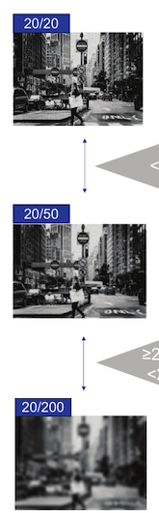
Characterization of Ocular Toxicities With
Belamaf-Based Regimens¹⁻³
N = 348
392 patients treated with belamaf-based regimens in DREAMM-7 (N = 242) and DREAMM-8 (N = 150)
No Clinically Meaningful Visual Activity Change, %
Common ocular AEs included blurred vision, dry eye, photophobia, foreign body sensation, and eye irritation
or pain
Majority of grade ≥2 OEFs were associated with no clinically meaningful change in visual acuity
Majority of patients did not have to stop reading or driving
49% (620/1,278) of these events were accompanied by an ocular AR
Overall grade ≥2 OEFs was 86% and 87% with BVd and BPd, respectively
62%
(n = 215)
<20/50
Clinically Meaningful Visual Activity Change, %
63% (493/777) of these events were accompanied by an ocular AR
≥20/50 to <20/50
36%
(n = 126)
BCVA changes to ≥20/200 were infrequent (2% [7/348]); resolved in all patients with adequate follow-up

Slide 66
Dose Modifications of Belamaf
Were Common and Didn’t Impact Efficacy¹
In DREAMM-7 and DREAMM-8, 92% and 94% of patients, respectively, sustained or deepened their response during their first extended dose delay
Last Assessed Response During First Extended Belamaf Dose Delay of >9 Weeks
DREAMM-7 (n = 127)
DREAMM-8 (n = 82)
 | Maintained or deepened response, %
 | PD, %
 | NE, %
 | Did not meet PD criteria, %

Slide 67
Dose Modifications Guided by Standard Assessments Can Manage and Reverse Ocular Events With Belamaf¹
Regimen | Severity of OEF | DREAMM-7 BVd (cycle length: 3 wk) | DREAMM-8 BPd (cycle length: 4 wk)
Standard schedule | No finding Grade 1 | 2.5 mg/kg Q3W | 2.5 mg/kg once in cycle 1 followed by 1.9 mg/kg Q4W from cycle 2
Reduced dose level 1 | Grade 2 Grade 3 | Dose delay until resolution to grade ≤1, then resume at same dose (2.5 mg/kg Q3W or 1.9 mg/kg Q3W) after grade 2 finding or 1.9 mg/kg Q3W after grade 3 finding | Dose delay until resolution of both components to grade ≤1, then 1.9 mg/kg Q8W
 | Grade 4 | Discontinuation or 1.9 mg/kg Q3W rechallenge after improvement and sponsor approval | –
Reduced dose level 2 | Grade 4 | NA | Dose delay until KVA grade ≤1, then 1.4 mg/kg Q8W
Standard-assessment guided dose modification can manage and reverse the emergence of ocular event (based on DREAMM-7 and -8 experience)²

Slide 68
Sustained, Deepened Responses With Dose-Modified Belamaf¹
Responses were maintained or deepened during/after the first extended dose delay (>2 cycles)
Patients with ≥1 extended delay (≥12 weeks) showed robust long-term PFS
Rates of VGPR or better increased markedly after the first delay
DREAMM-7: 45% → 75%
DREAMM-8: 55% → 87%
DREAMM-7
DREAMM-8
+
+
+
12 mo
+
+
+
12 mo
18 mo
+
+
+
18 mo
+
+
91
81
+
81
+
+
+
+
+
+
+
91
+
+
+
+
+
+
+
+
+
+
+
+
+
+
+
+
+
+
+
+
+
+
+
+
+
+
+
+
+
+
+
+
+
+
+
+
+
+
+
+
+
+
+
+
+
+
+
+
+
+
+
+
+
+
+
+
+
+
+
+
+
+
+
+
+
+
+
+
+
+
+
+
+
+
+
+
+
Proportion Alive and Progression Free
Proportion Alive and Progression Free
+
+
+
Median PFS: 36.3 (95% CI, 31.3-NR)
Median PFS: NR (95% CI, NR-NR)
Time Since Randomization, mo
Time Since Randomization, mo
No. at Risk | 146 | 145 | 144 | 139 | 134 | 128 | 121 | 116 | 106 | 102 | 99 | 95 | 91 | 84 | 65 | 44 | 23 | 10 | 5 | 2 | 1
No. at Risk | 98 | 96 | 93 | 93 | 91 | 89 | 83 | 72 | 68 | 64 | 56 | 44 | 32 | 23 | 18 | 11 | 4 | 1

Slide 69
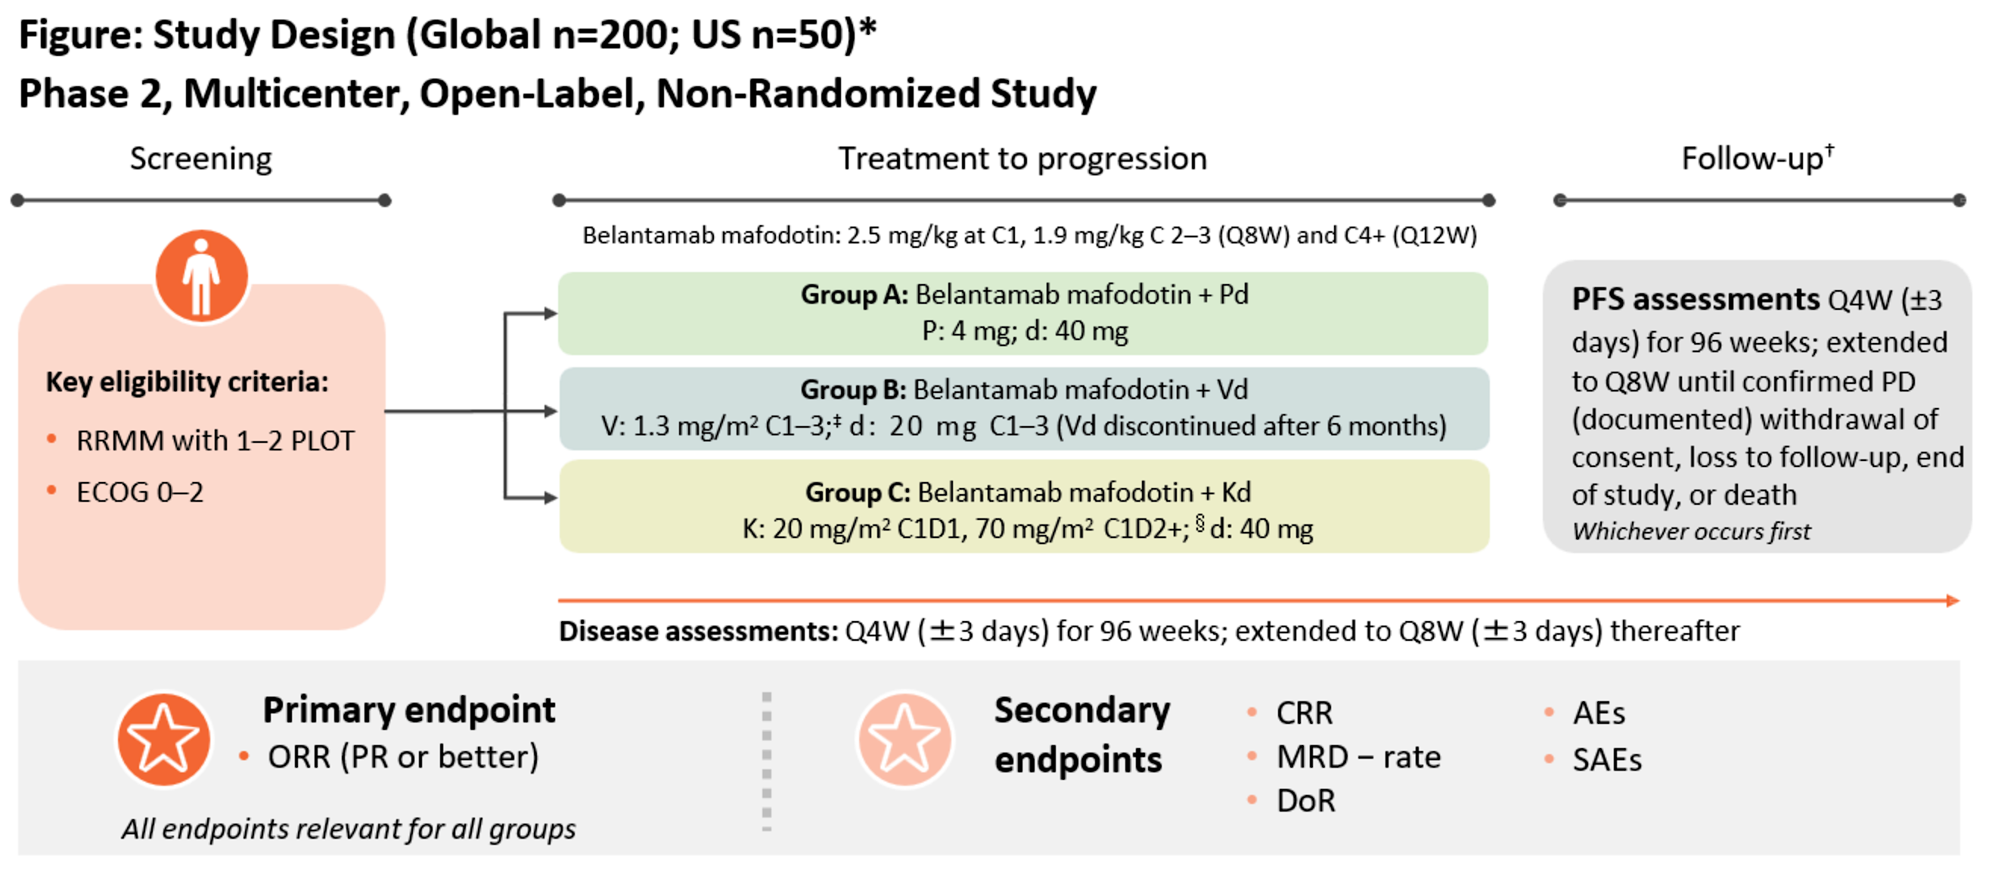
Extended Dosing of Belantamab Mafodotin:
Phase II DREAMM-15 Trial to Be Presented at EHA 2026
NCT07227311
Sborov D et al. EHA 2026;Abstract PB3225.

Slide 70
Patient Monitoring and Dosing Principles
With Belamaf-Containing Regimens¹
Before Cycle 1
Cycles 2-4
Cycles 5+
Eye specialist
Eye specialist
Eye specialist
Evaluation before each dose
Use KVA scale to inform whether dose modification is necessary
Baseline ophthalmic evaluation
Treating physician
Treating physician
Dose adjustment may be necessary
Administer VRA tool before each subsequent dose

Slide 71
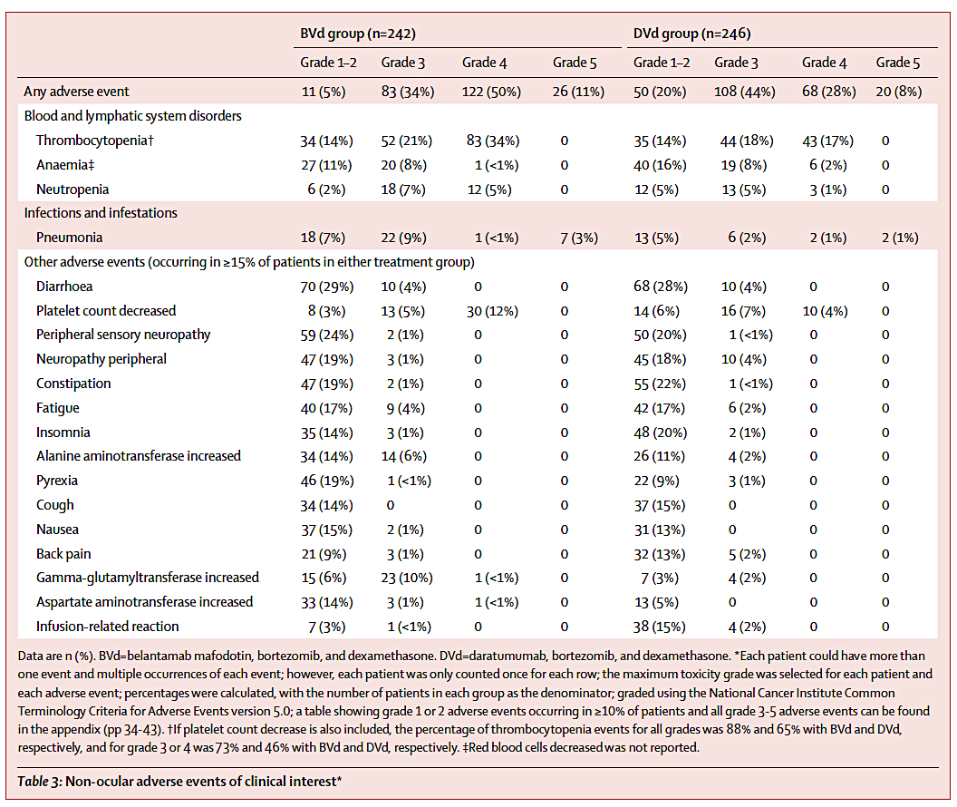
DREAMM-7 Study:
Safety Profile

Slide 72
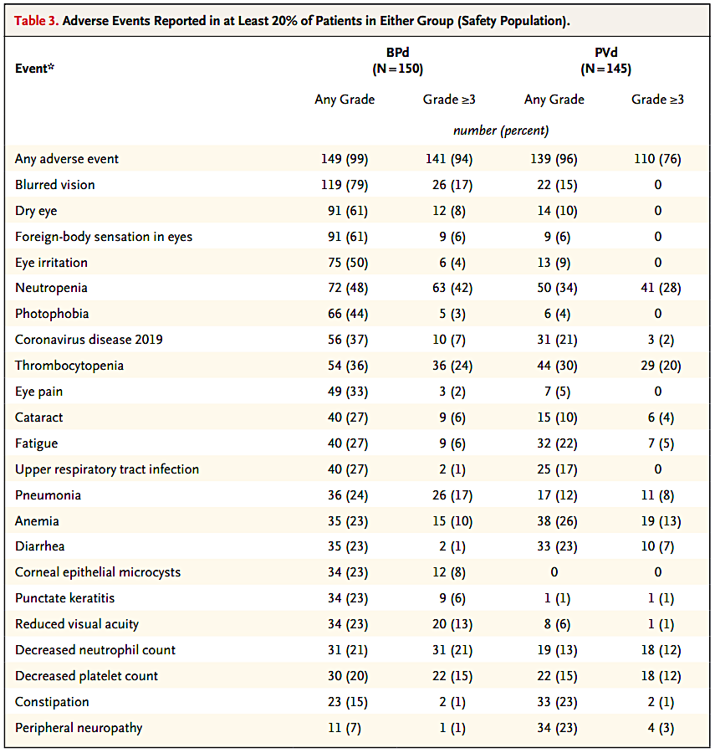
DREAMM-8 Study:
Safety Profile

Slide 73
DREAMM-9: Can We Move BCMA ADC Combinations Even Earlier in Myeloma Care?¹
DREAMM-9 is evaluating belamaf plus VRd (BVRd) in transplant ineligible (TI) NDMM
ORR: 100% with 1.9 mg/kg belamaf
MRD negativity: ≥73% in patients
with CR+
Using a stretched dosing schedule (Q6/8W) reduced rates of any grade ≥3 belamaf-related AEs, supporting the use of a 1.9 mg/kg starting dose with extended intervals to achieve an improved efficacy–safety profile in
TI NDMM
ORR
100
ORR
100
ORR
100
CR+
75
CR+
92
CR+
91
Patients, %
VGPR+
92
VGPR+
100
VGPR+
100

Slide 74
DREAMM-10: Belamaf Triplet Regimen in Transplant-Eligible MM¹
DREAMM-10 is evaluating belamaf plus Rd (BRd) in TI NDMM
BRd
Belamaf: 1.9 mg/kg IV Q8W x24 weeks,
1.9 mg/kg IV Q12W thereafter
Lenalidomide: 25 mg PO Days 1-21 of every 28-day cycle
Dexamethasone: 40 mg PO Days 1, 8, 15, and 22 of every 28-day cycle
Key Eligibility Criteria
Aged ≥18 years
TI-NDMM with requirement for treatment per IMWG criteria
Measurable disease
ECOG performance status 0-2
Adequate organ system function
TI NDMM
(N = ~520)
R
1:1
Randomization stratified by
Age (<75 vs ≥75 years)
International Staging System (I, II, III)
Region (North America, rest of world)
DRd
Daratumumab: 1800 mg SC on Days 1, 8, 15, and 22 of the 28-day cycle x8 weeks, Days 1 and 15 from Weeks 9-24, then Day 1 thereafter
Lenalidomide: 25 mg PO Days 1-21 of every 28-day cycle
Dexamethasone: 40 mg PO Days 1, 8, 15, and 22 of every 28-day cycle
Dual primary endpoints: MRD-negativity rate and PFS
Key secondary endpoints: OS, PFS2

Slide 75
Regulatory and reimbursement issues aside, what is the earliest timepoint in the treatment algorithm that you would administer belantamab mafodotin to patients with MM?
Third or fourth relapse
First relapse
Second relapse
First relapse
Fourth relapse
First relapse

Slide 76
If a patient with R/R MM were to ask you to estimate the likelihood that their disease would respond to belantamab mafodotin-based combination therapy, how would you respond?
If no prior BCMA-targeted therapy,
it could be very effective with PFS around 3 years
80% ORR
In combination over 80% ORR with predicted median PFS of 3 years
Greater that 80% response rate
Greater than 60% depending on prior BCMA-targeted agent exposure
Greater than 80% response rate
PFS = progression-free survival

Slide 77
Do you believe belantamab mafodotin has greater effi­cacy when used earlier in the treatment course?
Yes
Yes
Yes
Yes
Yes
Yes

Slide 78
Outside of a clinical trial, would you combine belantamab mafodotin with agents other than borte­zomib/dexamethasone under any circumstances?
Yes, pomalidomide; carfilzomib for patients
who cannot tolerate bortezomib
Yes, pomalidomide
Yes, either pomalidomide or CELMoDs
Yes, pomalidomide
Yes, pomalidomide
Yes, pomalidomide
CELMoDs = cereblon E3 ligase modulators

Slide 79
In general, would you recommend belantamab mafodotin to patients who previously received …
BCMA-directed CAR T-cell therapy
BCMA-directed CAR T-cell therapy and a BCMA-directed bispecific antibody
Yes, but only after testing
for serum BCMA
Yes, but only after testing
for serum BCMA
Yes
Yes
Yes, but only after testing
for serum BCMA
Yes, but only after testing
for serum BCMA
Yes
Yes, but only after testing
for serum BCMA
Yes, but after NGS for BCMA
Yes, but only after NGS for BCMA
Yes
Yes
NGS = next-generation sequencing

Slide 80
What strategies do you generally recommend for mitiga­tion of ophthalmic toxicities with belantamab mafodotin?
Screening and frequent visits with ophthalmology as per PI
Start with reduced dose of 1.9 mg/kg and go to every 8-12-week dosing early when used in combination
Dosing every 8-12 weeks based on side effects
Dose reduction and schedule change, natural tears
Adjust dose and interval of administration
Adjust dosing to every 8-12 weeks, learn patient’s “metabolism” for belantamab mafotodin, drug holds over dose reductions
PI = principal investigator

Slide 81
Do you adjust the dose or dosing frequency of belantamab mafodotin for patients with R/R MM who are experiencing a good response to treatment?
Yes, stop therapy if sustained CR, decrease frequency
if toxicity with good response
Yes, dose every 8 or 12 weeks
Yes, every 8 or 12 weeks after the first dose
Yes, dose every 8-12 weeks
Yes, space out administration intervals
Yes, reduce frequency to achieve no eye toxicity,
often to every 12 weeks or less frequently
CR = complete response

Slide 82
Agenda
Module 1: Integrating Bispecific Antibodies into the Management of Relapsed/Refractory (R/R) Multiple Myeloma (MM) — Dr Lee
Module 2: Current Utility of Antibody-Drug Conjugates for MM — Dr Lonial
Module 3: Potential Role of Cereblon E3 Ligase Modulators in Therapy for MM — Dr Richardson
Module 4: Chimeric Antigen Receptor T-Cell Therapy for R/R MM — Dr Alsina

Slide 83




Research To Practice CME Symposium
Consensus or Controversy?
Documenting and Discussing Investigators’ Approaches to the Management of Relapsed/Refractory Multiple Myeloma
ASCO 2026, Chicago, IL – Monday, June 1
Potential Role of Cereblon E3 Ligase Modulators (CELMoDs) in Therapy for Multiple Myeloma (MM)
Paul G. Richardson, MD
RJ Corman Professor of Medicine
Harvard Medical School
Clinical Program Leader, Director of Clinical Research
Jerome Lipper Multiple Myeloma Center
Dana-Farber Cancer Institute
Boston, Massachusetts, USA

Slide 84
Treatment of MM in 2026: multiple therapies approved or under investigation
Backbone/standard-of-care agents
Additional RRMM/recent approvals
Emerging therapies for RRMM**
IMiDs
PIs
mAbs
HDACis
ADCs
Targeted therapies
CAR T cell therapies
BiTEs® /
bispecifics
BiTEs® /
bispecifics
CELMoDs®
Lenalidomide
Bortezomib*
Daratumumab (CD38)
Panobinostat‡
Belantamab mafodotin‡
Selinexor
Idecabtagene vicleucel
Teclistamab (BCMAxCD3)
Etentamig (ABBV-383)† (BCMAxCD3)
Iberdomide†
Pomalidomide
Carfilzomib
Isatuximab (CD38)
Vorinostat†,#
AZD0305†
Melflufen‡
Ciltacabtagene autoleucel
Elranatamab (BCMAxCD3)
Alnuctamab†# (BCMAxCD3)
Mezigdomide†
Thalidomide
Ixazomib
Elotuzumab (SLAMF7)
Belantamab†
Venetoclax†,#
CAR T cell therapies
Talquetamab (GPRC5DxCD3)
Forimtamig† (GPRC5DxCD3)
Others
Marizomib†,#
Lisaftoclax†
Arlocabtagene autoleucel†
Linvoseltamab (BCMAxCD3)
Cevostamab† (FcRH5xCD3)
Cemsidomide, Inobrodib†
Strategies for managing MM, including doublet, triplet, and quadruplet combination regimens both upfront and in relapse, as well as treatment sequencing, are rapidly evolving in the context of this expanding therapeutic armamentarium
*Also approved in combination with liposomal doxorubicin (Doxil®). **Under investigation.
†Not currently approved in RRMM. ‡FDA approval withdrawn. #Development deprioritized.
ADCs, antibody–drug conjugates; BCMA, B-cell maturation antigen; BiTEs®, bispecific T-cell engagers; CAR, chimeric antigen receptor; CELMoDs®, cereblon E3 ligase modulators; CHMP, Committee for Medicinal Products for Human Use; COMy, Controversies in multiple myeloma; EMA, European Medicines Agency; FcRH5, Fc receptor-homolog 5; FDA, Food and Drug Administration; GPRC5D, G protein-coupled receptor family C group 5 member D; ICIs, immune checkpoint inhibitors; IMiDs®, immunomodulatory drugs; mAbs, monoclonal antibodies; PIs, proteasome inhibitors; RRMM, relapsed/refractory multiple myeloma.
Sonrotoclax†
Anitocabtagene autoleucel†
CAR NK cell therapies†
Durcabtagene autoleucel†
ICIs, Immuno-cytokines†,#
Adapted from Richardson PG. 5th Oxford Myeloma Workshop,
January 30–31, 2025, Oxford, UK.

Slide 85
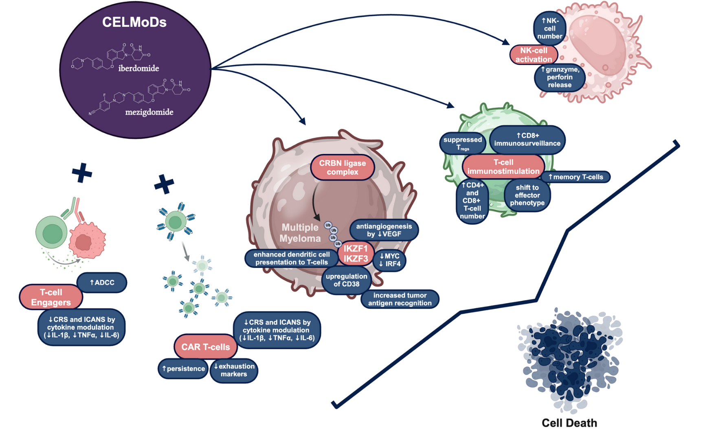
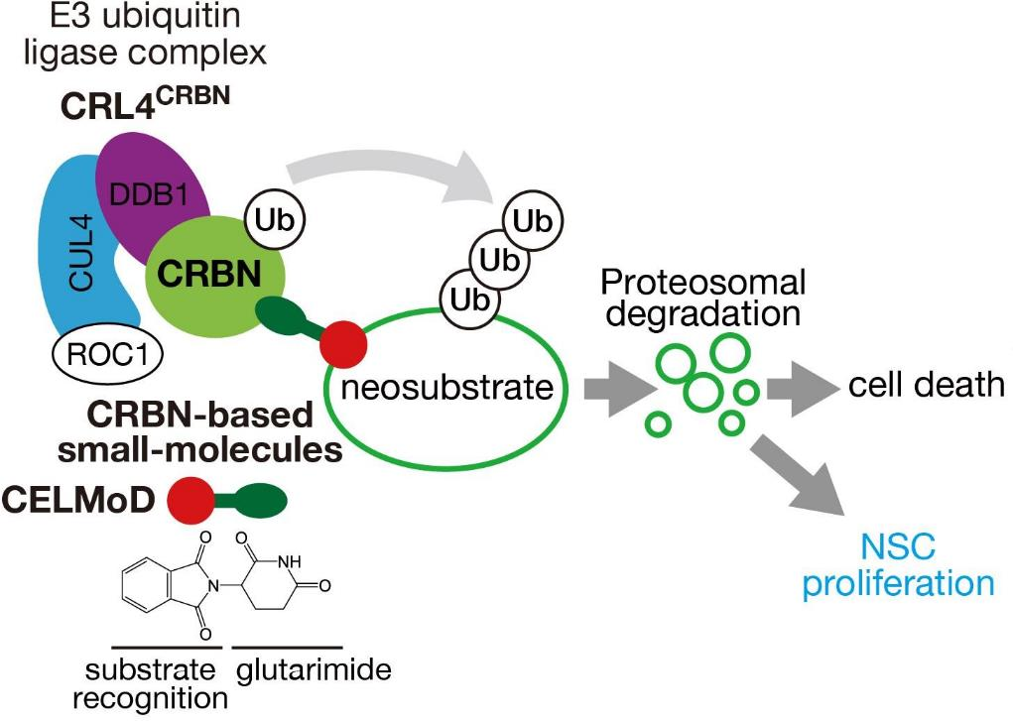
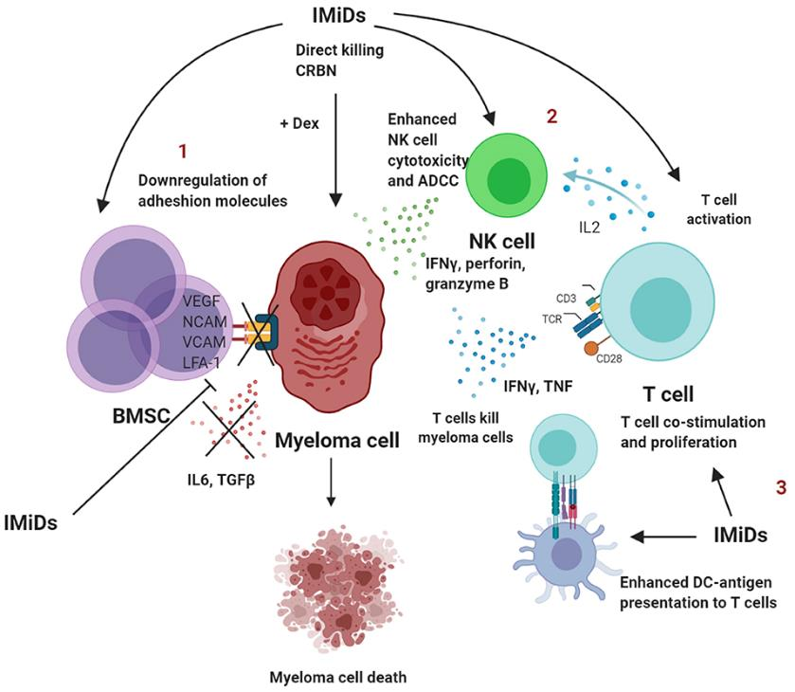
MOA of CELMoDs: iberdomide¹ and mezigdomide²
CELMoDs: overview of immunologic effects
/ CELMoDs
CELMoDs: MOA and immune effects
Neural stem cell proliferation
/ CELMoDs
/ CELMoDs
1. Lonial S, et al. Lancet Haematol 2022;9(11):e822–32. 2. Richardson PG, et al. N Engl J Med 2023;389(11):1009–22.
Figures adapted from: (left) Sato T, et al. Front Cell Dev Biol 2021;9:629326; (right) D’Souza C, et al. Front Immunol 2021;12:632399.
Kegyes D, et al. Biomarker Res 2025;13(1):105.

Slide 86


CELMoDs: summary of pharmacodynamics
Enhanced effects seen with anti-MM agents, potential mechanisms of resistance
Sensitization/potentiation
Direct immune/antitumor effects
Enhanced/synergistic effects
  ↑ Cytotoxicity of BCMA-targeted BsAb alnuctamab, greater enhancement of activity with mezigdomide vs pom
  ↑ Alnuctamab antitumor activity in vivo, T-cell activation, tumor tissue infiltration
  ↑ Adhesion molecules, T-cell-mediated killing
  ↑ Regressions and PFS in vivo with mezigdomide + GPRC5D-targeted BsAb forimtamig
  ↑ Durable responses, favorable T-cell profile
  ↑ Cytokine production
  ↑ T cell activation and proliferation
  ↑ NK cell cytotoxicity
  ↓ Exhausted/senescent T and NK cells
  Activated innate/adaptive immunity
  Modulation of adhesion molecules
  ↑ Antigen presentation via MHC-I
  ↑ Tumor growth inhibition, synergistic cell killing – mezigdomide + V±dex
  Potent immunomodulation with mezigdomide + Vd
  ↑ Apoptotic activity vs pom with mezigdomide + V or K at 100-fold lower concentration of mezigdomide vs pom
  Near-complete regressions, prolonged survival in vivo with mezigdomide + Vd vs pom-Vd
Mezi overcomes CRBN mutations emerging post IMiD therapy
2025
  Mezigdomide interacts with additional moieties outside of the thalidomide binding domain
  May affect the stabilization of cereblon or the CRL4CRBN E3 ligase complex
  May result in clinical responses
  Not seen with pomalidomide
  Watson E, et al. Blood 2025;146(Supplement 1):436.
+BsAbs
+PIs
Enhanced viability/persistence
CUL4A
CD38 priming, enhanced apoptosis
  ↑ Viability in IL-2-starved CAR T cells
  ↑ Activation markers HLA-DR, CD69
  ↑ Effector memory phenotype CAR T cells
  ↑ Production of IL-2, IL-17a, TNFα antigen-specific cytokines by CD8+ and CD4+ CAR T cells against BCMA-expressing MM cells
  ↑ Antigen-specific toxicity
DDB1
  ↑ CD38 cell surface expression
  ↑ ADCC / ADCP with subsequent Dara
  ↑ Apoptosis with mezigdomide + Dara
  ↑ Proliferative CD3+ T cells, effector memory CD4+ T cells, HLA-DR-expressing CD4+ T cell activation
+CAR T
RBX1
+mAbs
CRBN
Ikaros/ Aiolos
Mezi
+Novel
Potential resistance mechanisms
CKS1B downregulation
  CRBN alterations
  Monoallelic 3p26 loss
  ↓ Expression of COP9 signalosome protein complex
  ↑ USP15 expression
  Alterations in SREBP lipid synthesis pathway
  High baseline EZH2 expression → poorer PFS
  ↑ Apoptosis, ↓ cell proliferation with mezigdomide + bromodomain-containing protein 4 (BRD4) inhibitor
  Potential for activity in gain/amp 1q21 MM
Mo CC, et al. Expert Opin Emerg Drugs 2025;30(3):209–19.

Slide 87
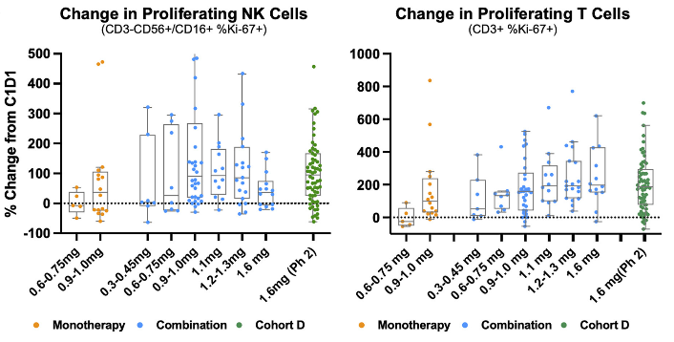
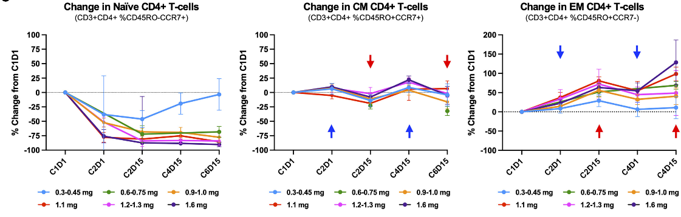
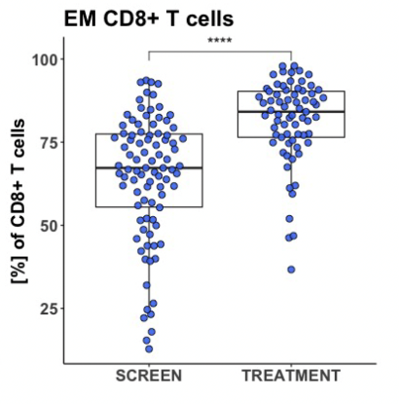
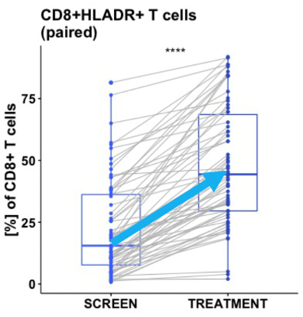
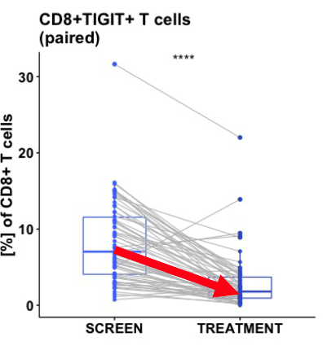
Iberdomide: immune cell responses
Immunostimulatory effects:¹
increased proliferating (Ki-67+) NK and T cells
T-cell subset analysis:¹ shift from naïve to activated, effector-memory T cell phenotype with iberdomide, with decrease in naïve T cells and increase in effector-memory T cells
Paired BM sample analysis of iberdomide effects²
Increased effector cell abundance
Increased
activation
Decreased exhaustion
1. Amatangelo M, et al. Cell Rep Med 2024;5(6):101571.
2. Van Oekelen O, et al. Cell Rep Med 2024;5(6):101684.

Slide 88
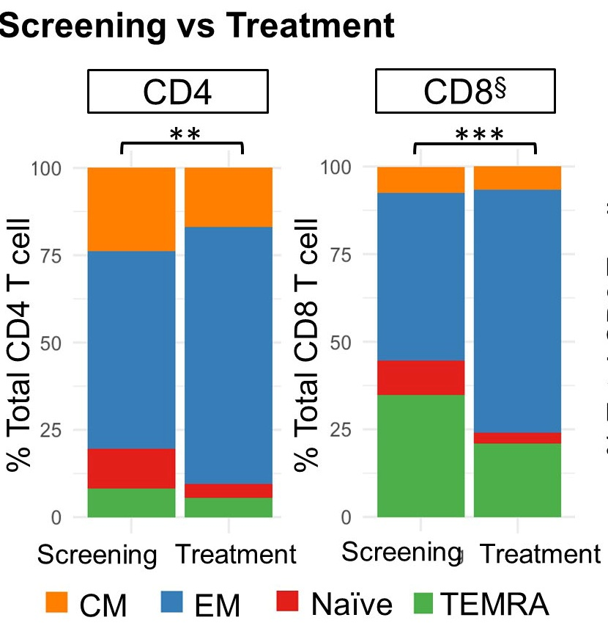
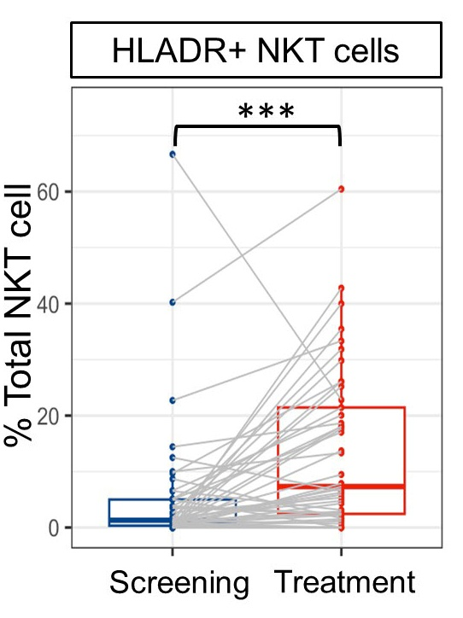
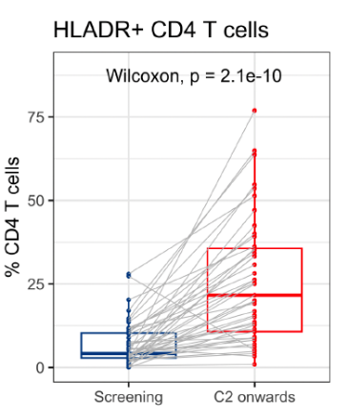
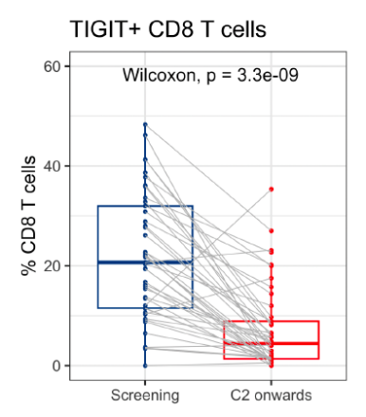
Mezigdomide: immune cell responses
Paired BM sample analysis of mezigdomide effects¹
Shift towards effector T cell phenotype
Increased
activation
Increased
activation
Decreased
exhaustion
Mechanistic rationale for enhanced antitumor immunity
2025
  Mezigdomide and iberdomide significantly decrease induction of monocytic myeloid-derived suppressor cells (mMDSCs)
  Significant upregulation of inflammatory response genes in MM cells
  Reduced expression of key immunosuppressive mediators IL-10 and MIF
  Mechanisms contribute to remodelling tumor microenvironment towards an immune-permissive state
  Niiyama-Uchibori Y, et al. Blood 2025;146(Supplement 1):7447.
Chen, LY et al. Blood 2023;142(Supplement 1):4686.

Slide 89

CELMoD doublet for later-relapse RRMM
Mezigdomide + dex: Phase 1/2 study, N=178
CC-92480-MM-001 first-in-human phase 1 trial: Mezigdomide + Dex
Dose escalation
30% high-risk cytogenetics, 35% EMD
Median 6 prior therapies
56% triple-class-refractory
Efficacy in dose expansion cohort
Median DOR 7.6 months
77 heavily pretreated RRMM patients
Dose expansion at RP2D
101 heavily pretreated RRMM patients
37% high-risk cytogenetics, 40% EMD
Median 6 prior therapies
100% triple-class-refractory
Median PFS 4.4 months
In patients with prior anti-BCMA therapy, median DOR 6.9 months and median PFS 5.4 months
ORR 25%
ORR 41%
ORR 30%
ORR 50%
Mezigdomide: updates in RRMM
Safety in dose escalation/expansion cohorts
Grade 3/4 neutropenia 71%/76%, anemia 38%/36%, thrombocytopenia 24%/28%, febrile neutropenia 9%/15%
Infections 74%/65% (Grade 3/4 40%/35%)
Treatment discontinuation due to AEs NR/6%
Richardson PG, et al. N Engl J Med 2023;389(11):1009–22.

Slide 90
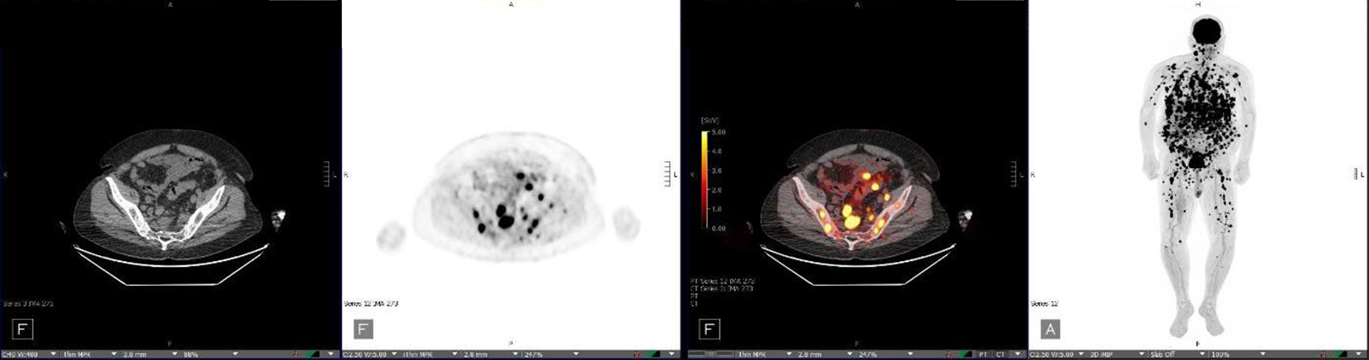
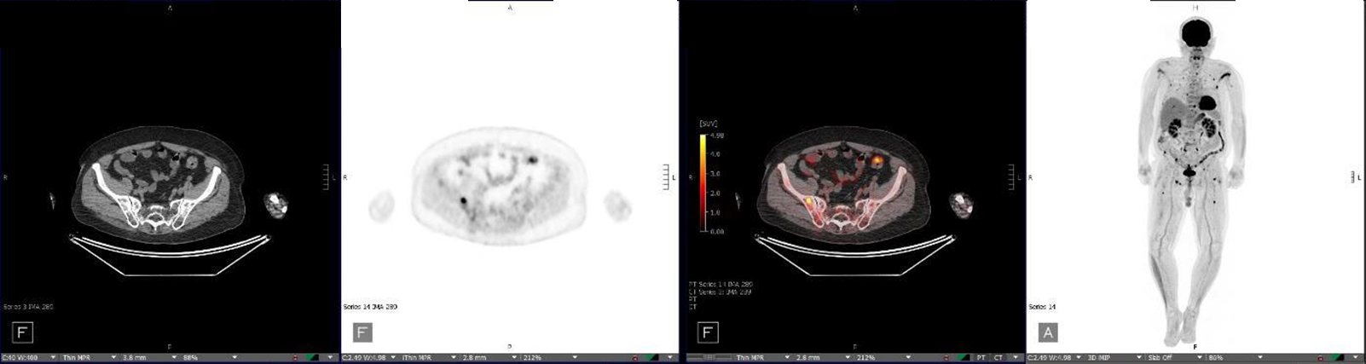
CELMoD doublet for later-relapse RRMM
Mezigdomide + dex induces responses in patients with EMD
At start of treatment (study entry)
After 4 months of treatment with Mezi 1.0 mg,
D1–21 every 28 days, + Dex
Richardson PG, et al. Blood 2022;140(Supplement 1):1366–8. Richardson PG, et al. N Engl J Med 2023;389(11):1009–22.

Slide 91
CELMoD triplets for RRMM: mezigdomide–PI regimens
Mezigdomide + Vd or Kd
CC-92480-MM-002 Phase 1/2 Study: Mezigdomide + Vd / Kd^{1,2}
Mezigdomide + Vd (N=28)
42.9% high-risk cytogenetics
Mezigdomide + Vd 1.0mg (N=38) / 0.6 mg (N=11)
53.1% high-risk cytogenetics
Mezigdomide + Kd (N=27)
59.3% high-risk cytogenetics
Median 3 prior therapies
Median 1 prior therapy
Median 2 prior therapies
82.1% R-refractory
63.3% R-refractory
77.8% R-refractory
50.0% PI-refractory
16.3% PI-refractory
51.9% PI-refractory
50.0% CD38 mAb-refractory
34.7% CD38 mAb-refractory
74.1% CD38 mAb-refractory
Median duration of treatment: 12.5 cycles
Median duration of treatment: 15 cycles
Median duration of treatment: 12 cycles
Mezigdomide + Vd
(N=28, dose escalation)
Mezigdomide + Vd
(1.0 mg, N=38 / 0.6 mg, N=11)
Mezigdomide + Kd (N=27)
ORR 75.0%
ORR 84.2%
ORR 90.9%
ORR 61.5%
Median DOR 10.9 months
Median PFS 11.2–13.4 months
Grade 3/4 neutropenia 35.7%
Grade 3/4 thrombocytopenia 21.4%
Grade 3 anemia 14.3%
Infections 71.4% (Grade 3/4 17.9%)
Grade 3/4 pneumonia 10.7%
Median DOR 19.4 months
Median PFS 16.6 / 20.8 months
Grade 3/4 neutropenia 63.3%
Grade 3/4 thrombocytopenia 26.5%
Grade 3 anemia 6.1%
Infections 79.6% (Grade 3/4 32.7%)
Grade 3/4 pneumonia 22.4%
Median DOR 11.9 months
Median PFS 11.7–13.8 months
Grade 3/4 neutropenia 44.4%
Grade 3/4 thrombocytopenia 14.8%
Grade 3/4 anemia 14.8%
Infections 70.4% (Grade 3/4 33.3%)
Grade 3/4 pneumonia 3.7%
1. Oriol A, et al. Clin Lymphoma Myeloma Leukemia 2023;23(Suppl 2):S31.
2. Sandhu A, et al. Blood 2024;144(supplement 1):1025.

Slide 92
Phase 3 studies of CELMoD triplets in RRMM: combination with SOC mAbs or PIs
Study
Treatment
SUCCESSOR-1 (NCT05519085)¹
~810 patients
1–3 prior lines
Stage 1: Mezi + Vd
Determine recommended Mezi dose
Mezi + Vd
Primary endpoint: PFS
Primary completion: Jan 2027
Stage 2
Pom-Vd
SUCCESSOR-2 (NCT05552976)²
~606 patients
≥1 prior line
Stage 1: Mezi + Kd
Determine recommended Mezi dose
Mezi + Kd
Primary endpoint: PFS
Primary completion: Mar 2026
Stage 2
Kd
Iber 1.0 mg + Dara-dex
Primary endpoint: PFS
EXCALIBER-RRMM
(NCT04975997)³
Stage 1
~200 patients
1–2 prior lines
Iber 1.3 mg + Dara-dex
Stage 2
~664 patients
1–2 prior lines
Iber + Dara-dex
Iber 1.6 mg + Dara-dex
Dara-Vd
Primary completion: Nov 2027
Dara-Vd
1. Richardson PG, et al. Clin Lymphoma Myeloma Leuk 2023;23(Supplement 1):S495–6, abstract MM-372.
2. Richardson PG, et al. J Clin Oncol 2023;41(16_suppl):abstract TPS8070.
3. Lonial S, et al. Future Oncol 2025;21(14):1761–9.

Slide 93

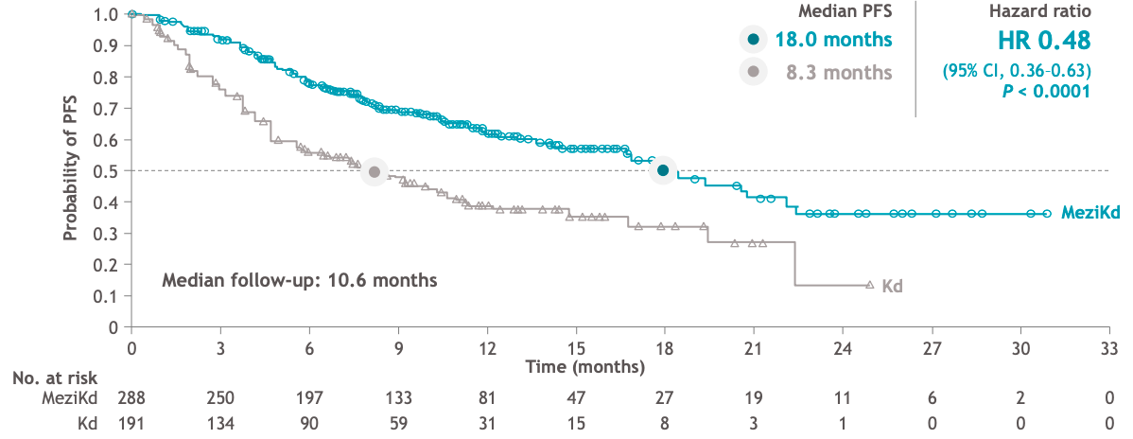
CELMoD triplets for RRMM: mezigdomide–PI regimen
Phase 3 SUCCESSOR-2 trial of mezigdomide + Kd vs Kd
N= 606; Stage 1 ~ dose optimization n=235, Stage 2 ~ efficacy and safety n=372, with total confirmatory analysis by ITT in 479 patients
PFS: Primary Endpoint
In anti-CD38 mAb- and LEN-exposed patients who had received ≥ 1 prior LOT (range 1-9), MeziKd significantly reduced risk of progression or death by 52%.
Richardson PG, et al. J Clin Oncol 2026;44(16_suppl):LBA7506.

Slide 94
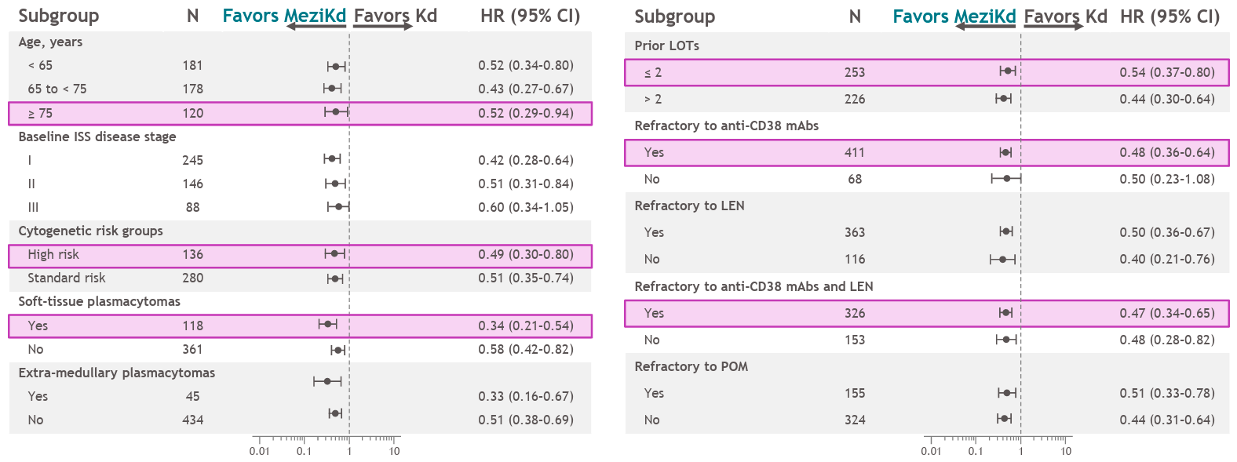
CELMoD triplets for RRMM: mezigdomide–PI regimen
Phase 3 SUCCESSOR-2 trial of mezigdomide + Kd vs Kd
Confirmatory analysis group by ITT(n = 479)
PFS Subgroup Analyses
PFS survival benefit with MeziKd superior across all prespecified subgroups.
Richardson PG, et al. J Clin Oncol 2026;44(16_suppl):LBA7506.

Slide 95
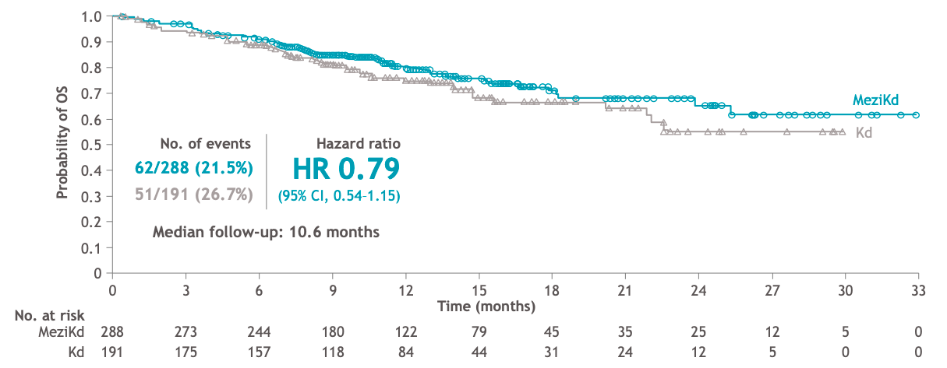
CELMoD triplets for RRMM: mezigdomide–PI regimen
Phase 3 SUCCESSOR-2 trial of mezigdomide + Kd vs Kd
Confirmatory analysis group by ITT (n = 479)
OS: Key secondary endpoint
Planned futility analysis demonstrates a positive OS trend favoring MeziKd
with no cross over of the curves.
Richardson PG, et al. J Clin Oncol 2026;44(16_suppl):LBA7506.

Slide 96
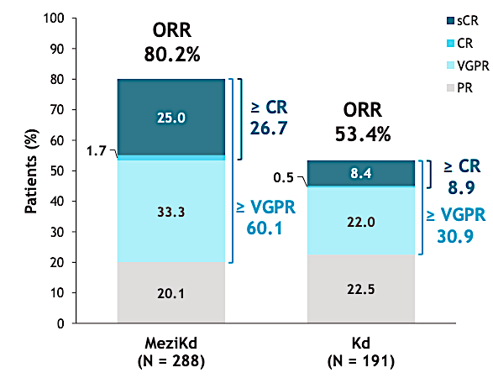
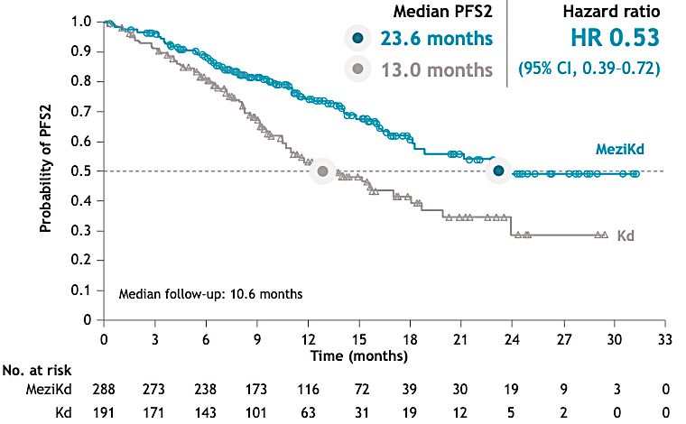
CELMoD triplets for RRMM: mezigdomide–PI regimen
Phase 3 SUCCESSOR-2 trial of mezigdomide + Kd vs Kd
Confirmatory analysis group by ITT (n = 479)
Treatment response
PFS2
Time to response 1.1 mos 1.1 mos
12-month DoR 72% 54%
Richardson PG, et al. J Clin Oncol 2026;44(16_suppl):LBA7506.

Slide 97

CELMoD triplets for RRMM: mezigdomide - PI regimen
Phase 3 SUCCESSOR-2 trial of mezigdomide + Kd vs Kd
Confirmatory analysis group for safety (n = 474)
Most common TEAEs
Neutropenia was the most common grade 3/4 AE and was managed
effectively with dose interruptions/modifications and/or G-CSF
Richardson PG, et al. J Clin Oncol 2026;44(16_suppl):LBA7506.

Slide 98

CELMoD triplets for RRMM: mezigdomide–PI regimen
Phase 3 SUCCESSOR-2 trial of mezigdomide + Kd vs Kd
Confirmatory analysis group for safety (n= 474)
Summary of infections
Infections were mostly well managed following standard clinical
practice and supportive care, with low incidence of grade 4 events.
Richardson PG, et al. J Clin Oncol 2026;44(16_suppl):LBA7506.

Slide 99

Contextualization of Clinical Benefit seen in SUCCESSOR 2 for
Anti-CD38 mAb- and LEN-exposed RRMM Patients across multiple settings
SUCCESSOR-2
SUCCESSOR-2
Phase 3 ITT
SELECT¹
Phase 2
KARMMA-3²
Phase 3 ITT
CARTITUDE-4³
Phase 3 DARA-exposed subgroup
HR: 0.48
HR: 0.49
HR: 0.24
Median PFS, months
KPd
N= 191
N = 288
N = 52
N = 132
N = 254
N = 54
N = 51
Median prior LOT, n (range) | 2 (1–9) | 2 (1–9) | 2 (1–2) | 3 (2-4) | 3 (2-4) | NR | NR
LEN-ref., % | 76.9 | 74.4 | 100 | 73 | 79 | 100 | 100
Anti CD38 mAb-exposed, % | 100 | 100 | 77 | 100 | 100 | 100 | 100
Anti CD38 mAb-refractory, % | 85.3 | 86.1 | 75 | 95 | 94 | 83.3 | 90.5
Trials are not intended for direct comparison. Side-by-side data are presented solely to summarize information.
All patient were exposed to LEN. DPd, daratumumab, pomalidomide, and dexamethasone; IIT, intention-to-treat; NR, not reported; PVd, pomalidomide, bortezomib, and dexamethasone; SR, standard of care regimen.
1. Perrot A, et al. Leuk Lymphoma 2024;65(6):833-842; 2. Ailawadhi S, et al. Blood 2024;144(23):2389-2401; 3. Einsele H, et al. Lancet Oncol 2026;27(2):254-268.
Richardson PG, et al. ASCO 2026, Presentation LBA7506

Slide 100
CELMoD triplets for RRMM: mezigdomide–mAb regimens
Mezigdomide + Dara-dex or Elo-dex
CC-92480-MM-002 Phase 1/2 Study: Mezigdomide + Dara-dex / Elo-dex¹
Mezigdomide + Dara-dex (N=56)
Mezigdomide + Elo-dex (N=20)
Median 3 prior therapies
Median 2 prior therapies
82.5% IMiD-refractory
85% prior CD38 mAb
61.4% PI-refractory
Median age 67 years
Median time since diagnosis 8.2 years
15.8% prior ASCT
8.8% prior CD38 mAb
Mezigdomide + Dara-dex (N=56)
Mezigdomide + Elo-dex (N=20)
ORR 75.0%
ORR 45%
DOR / PFS not mature
Grade 3/4 neutropenia 53.6%
Grade 3/4 thrombocytopenia 7.1%
Grade 3/4 anemia 10.7%
Grade 3/4 infections 19.6%
DOR / PFS not mature
Grade 3/4 neutropenia 40%
Grade 3/4 thrombocytopenia 10%
Grade 3/4 anemia 20%
Grade 3/4 infections 35%
1. Richardson PG, et al. Blood 2023;142(supplement 1):1013.

Slide 101


CELMoD triplets for later-relapse RRMM: combination with targeted agents
STOMP Arm 12: Mezigdomide + Selinexor-dex
2025
Patient demographics and baseline characteristics​
Cohort 1
40 mg Seli
0.6 mg Mezi
40 mg Dex
As of Oct 10, 2025, a total of 13 patients have been enrolled
3 in Cohort 1 seli 40 mg QW/mezi 0.6 mg QD/dex 40 mg QW
3 in Cohort 2 seli 60 mg QW/mezi 0.6 mg QD/dex 40 mg QW
7 in Cohort 3 seli 60 mg QW/mezi 1.0 mg QD/dex 40 mg QW
Characteristics | Total (N = 13)
Time since diagnosis (years), median (range) | 7.5 (2.7–22.0)
Extramedullary lesions, n (%) | 3 (23)
Number of prior lines of therapy, median (range) | 5 (2–12)
Exposure to at least one IMiD, n (%) | 13 (100)
Exposure to at least one PI, n (%) | 13 (100)
Exposure to at least one anti-CD38 antibody, n (%) | 13 (100)
Exposure/refractory to T-cell redirecting treatment,† n (%) | 3 (23)
Exposure/refractory to belantamab mafodotin, n (%) | 3 (23)
Exposure/refractory to iberdomide, n (%) | 1 (7)
Prior ASCT, n (%) | 9 (69)
Refractory to at least one IMiD, n (%) | 12 (92)
Refractory to at least one PI, n (%) | 10 (77)
Refractory to at least one anti-CD38 antibody, n (%) | 13 (100)
Refractory to last line of treatment, n (%) | 12 (92)
Cohort 2
60 mg Seli
0.6 mg Mezi
40 mg Dex
Stable Disease
MR
PR
VGPR
CR
(EOT) Progressive disease
(EOT) Death
(EOT) Adverse event
(EOT) Withdrew consent
Characteristics | Total (N = 13)
Age (years), median (range) | 66 (42–83)
≥ 75 years, n (%) | 2 (15)
Sex (male), n (%) | 9 (69)
Race, n (%)
African American | 3 (23)
Native Hawaiian or Pacific Islander | 1 (8)
White | 9 (69)
ECOG performance status, n (%)
0 | 8 (62)
1 | 5 (39)
ISS disease stage, %
I | 9
II | 2
III | 2
Cohort 3
60 mg Seli
1.0 mg Mezi
40 mg Dex
Safety
Common treatment-emergent AEs: neutropenia 85%, thrombocytopenia 62%, constipation 54%, leukopenia 54%
Most common Grade 3/4 treatment-emergent AE: neutropenia (54%)
ORR: 50% (6/12) – all VGPR or better
Mo CC, et al. Blood 2025;146(Supplement 1):4010. Mo C, et al. 7th European Myeloma Network Meeting, April 16–18, 2026, Prague, Czechia, poster #P43.

Slide 102

CELMoD triplets for later-relapse RRMM: combination with targeted agents
STOMP Arm 12: Mezigdomide + Selinexor-dex
2025
Mezi-Seli-dex results in CD8+ T cell proliferation and activation
CD8+: Functional Markers
85.8
127.0
-6.0
60.3
18.5
-2.6
0.1
-29.6
26.9
6.0
-3.6
800
250
Mezigdomide + Selinexor-dex: potential strategy for overcoming immune exhaustion
Use of T cell ‘energizing’ regimen before or after T cell exhausting agents
100
Percent change at Week 4 Relative to Baseline
50
0
Increase in median expression of markers related to CD8 expansion (Ki67, CD38) and MHC-II expression (HLA-DR) and decrease in marker of senescence (CD57) were observed across all dose cohorts
-50
-100
Ki67
CD38
CD226
HLA-DR
BHLA-DR
Granzyme B
Tbet
CD57
PD-1+
Tim3
TIGIT
Mo CC, et al. Blood 2025;146(Supplement 1):4010. Mo C, et al. 7th European Myeloma Network Meeting, April 16–18, 2026, Prague, Czechia, poster #P43.

Slide 103


CELMoD triplets for later-relapse RRMM: combination with targeted agents
STOMP Arm 12: Mezigdomide + Selinexor-dex
2025
Mezi-Seli-dex upregulates T-cell activation-related cytokines and
suppresses pro-inflammatory cytokines inversely associated with poor MM prognosis
Median percent change in cytokine levels compared to C1D1
Category
Prognostic association with MM
Negative
C1D1 vs C1D15
Positive and negative reported
None
Comparison
% Median Change
C1D1 vs C2D1
100
50
0
-50
-100
C1D1 vs C2D15
IL-21
sFas
IL-7
IL-4
IL-5
IL-6
IL-2
Cytokine panel testing in primary patient samples indicated increased T-cell activation signaling (IL-21, Perforin) during on (C1D15, C2D15) and off-treatment (C2D1) periods
Perforin
GM-CSF
IL-1 beta
IL-23
IL-13
IL-10
IL-12 (p70)
IFN gamma
TNF-alpha
IL-8_CXCL8
sFasL_TNFRSF6
IL-17A_CTLA8
Granzyme A
I-TAC_CXCL11
Granzyme B
Fractaline_CX3CL1
MIP-1 alpha_CCL3
sCD137_4-1BB_TNFRSF9
MIP-1 beta_CCL4
MIP-3 alpha_CCL20
Pro-inflammatory cytokines and IL-8, IL-6, and TNF-alpha decreased modestly with SMd treatment. These cytokines have also been shown to negatively correlate with MM prognosis.¹⁻³
Mo CC, et al. Blood 2025;146(Supplement 1):4010. Mo C, et al. 7th European Myeloma Network Meeting, April 16–18, 2026, Prague, Czechia, poster #P43.
1. Zhang XG, et al. Blood 1989;74:11–13. 2. Herrero AB, et al. Am J Path 2016;186:2171–82. 3. Jourdan M, et al. Eur Cytokine Netw 1999;10:65–70.

Slide 104
CELMoD triplets for later-relapse RRMM: combination with novel targeted agents
Mezigdomide-dex + tazemetostat (EZH2 inhibitor) /
BMS-986158 (BET inhibitor) / trametinib (MEK inhibitor)
CA057-003 (NCT05372354) Phase 1/2 trial in patients with RRMM
Mezi-dex + Taz (N=16)
31.3% high-risk cytogenetics
Mezi-dex + BMS-986158 (N=20)
30.0% high-risk cytogenetics
Mezi-dex + Tram (N=20)
15.0% high-risk cytogenetics
Median 5 prior lines
Median 5 prior lines
Median 4 prior lines
68.8% prior T-cell redirecting therapy
60.0% prior T-cell redirecting therapy
45.0% prior T-cell redirecting therapy
87.5% CD38 mAb-refractory
85.0% CD38 mAb-refractory
90.0% CD38 mAb-refractory
90.0% triple-class refractory
81.3% triple-class refractory
75.0% triple-class refractory
Mezi-dex + Taz
(N=16, dose escalation)
Mezi-dex + BMS-986158 (N=20, dose escalation)
Mezi-dex + Tram
(N=20, dose escalation)
ORR 50.0%
ORR 35.0%
ORR 75.0%
Median DOR not reached
Median PFS 6.7 months
Grade 3/4 neutropenia 50.0%
Grade 3/4 thrombocytopenia 6.1%
Grade 3 anemia 12.5%
Infections 68.8% (Grade 3/4 25.0%)
Grade 3/4 pneumonia 12.5%
Median DOR not reached
Median PFS 4.6 months
Grade 3/4 neutropenia 65.0%
Grade 3/4 thrombocytopenia 40.0%
Grade 3 anemia 35.0%
Infections 50.0% (Grade 3/4 15.0%)
Grade 3/4 pneumonia 5.0%
Median DOR 6.5 months
Median PFS 8.7 months
Grade 3/4 neutropenia 80.0%
Grade 3/4 thrombocytopenia 15.0%
Grade 3/4 anemia 15.0%
Infections 85.0% (Grade 3/4 25.0%)
Grade 3/4 pneumonia 5.0%
Costa LJ, et al. Blood 2024;144(supplement 1):677.

Slide 105
Phase 3 studies of CELMoD triplets in RRMM: combination with SOC mAbs or PIs
Study
Treatment
SUCCESSOR-1 (NCT05519085)¹
~810 patients
1–3 prior lines
Stage 1: Mezi + Vd
Determine recommended Mezi dose
Mezi + Vd
Primary endpoint: PFS
Primary completion: Jan 2027
Stage 2
Pom-Vd
SUCCESSOR-2 (NCT05552976)²
~525 patients
≥1 prior line
Stage 1: Mezi + Kd
Determine recommended Mezi dose
Mezi + Kd
Primary endpoint: PFS
Primary completion: Mar 2026
Iberdomide: updates in RRMM
Stage 2
Kd
Feb 2026: US FDA accepts NDA for iberdomide in RRMM
  NDA for iberdomide plus Dara-dex in RRMM
    Also granted Breakthrough Therapy designation
  Based on planned analysis of MRD-neg rates in EXCALIBER-RRMM
  PDUFA date: August 17, 2026
  BMS Press Release. See https://www.myeloma.org/news-events/multiple-myeloma-news/fda-accepts-new-drug-application-iberdomide-rrmm
Primary endpoint: PFS
Iber 1.0 mg + Dara-dex
EXCALIBER-RRMM
(NCT04975997)³
Stage 1
~200 patients
1–2 prior lines
Iber 1.3 mg + Dara-dex
Stage 2
~664 patients
1–2 prior lines
Iber + Dara-dex
Iber 1.6 mg + Dara-dex
Dara-Vd
Primary completion: Nov 2027
Dara-Vd
1. Richardson PG, et al. Clin Lymphoma Myeloma Leuk 2023;23(Supplement 1):S495–6, abstract MM-372.
2. Richardson PG, et al. J Clin Oncol 2023;41(16_suppl):abstract TPS8070.
3. Lonial S, et al. Future Oncol 2025;21(14):1761–9.

Slide 106
CELMoD triplets and quadruplets for RRMM: combination with mAbs or PIs
Iberdomide + Isa-dex or Dara-Kd
2025
Iberdomide + Isa-dex for functional high-risk RRMM
IBIS AMaRC 20-01 study¹
Iberdomide + Dara-Kd in RRMM
(Phase 2 ReKInDLE study)²
29/50 functional high-risk RRMM patients relapsing ≤18 months after first-line therapy
Efficacy, follow-up ≥12 months
ORR 69%
9-month PFS 51% / OS 82%
Safety
Grade 3/4 neutropenia 52%, insomnia 8%, infusion-related reaction 2%, upper respiratory tract infection 4%
Of 29 patients, 15 progression-free and alive, 8 alive with PD, 6 died
Median age 65 years (range 43–82)
24% R-ISS III
1 / 2 / 3 HRCAs in 32% / 16% / 12% (N=50)
Median time to IBIS salvage 6.3 months
2 grade 5 AEs: lung infection, sepsis
Median age 63 years (range 44–77); 33% high-risk (IMWG 2025); 16% EMD
Efficacy
ORR 92% (38% ≥CR, 35% VGPR)
Safety
Grade ≥3 hematologic AEs: 50% neutropenia, 10% thrombocytopenia, 3% anemia
30 RRMM patients after 1–3 prior lines
Median 1 prior line
93% R-refractory; 27% CD38 mAb-exposed; 30% prior K
47% prior ASCT
8/12 (67%) MRD-neg CR and PET-neg
27 patients remain on treatment for up to 17 months
6 (20%) SAEs, including 3 (10%) lung infections
ALLG MM25 (Viber-M): Iberdomide + venetoclax + dex
in t(11;14) RRMM (N=44)
Iber maintenance post salvage ASCT
2025
2025
  Analysis in first 20 patients
  Median age 65 yrs
  75% 1 prior line, 25% 2 prior lines; 75% R exposed (65% R-refractory), 20% CD38 mAb-refractory
  ORR 80%; 25% ≥VGPR
  Grade ≥3 AEs 55%, including neutropenia 45%, thrombocytopenia 10%, infections 20%
  Sim S, et al. Blood 2025;146(Supplement 1):249.
  15 patients with RRMM undergoing salvage ASCT
  Median age 61 yrs; 66% high-risk cytogenetics
  Median 2 prior lines; 73% triple-class refractory
  Post salvage ASCT: 7% CR/MRD-neg, 33% CR/MRD-pos, 13% VGPR, 33% PR, 14% SD
  Median follow-up 15.4 months
  Best response to iberdomide: 25% CR/MRD-neg, 25% VGPR, 25% PR, 25% SD
  Median PFS from start of iberdomide 9.3 months
  Grade 3 AEs: 1 neutropenia, 2 maculopapular rash, 3 infections
  Tijaro Ovalle N, et al. Blood 2025;146(Supplement 1):4048.
1. Lim S-L, et al. Blood 2025;146(Supplement 1):5841. 2. Landgren O, et al. Blood 2025;146(Supplement 1):251.

Slide 107

Overcoming T-cell exhaustion
Improving CAR T-cell function with CELMoDs
2024
In vitro evaluation of impact of mezigdomide and iberdomide
Preclinical benefit of CELMoD-dex on TCE outcome
Immune system reactivation with mezigdomide regimens
2024
  Evaluation of the persistence, proliferation, and activation of healthy donor-derived anti-BCMA CAR T cells in response to addition of CELMoDs
  40-color spectral flow cytometry panels used to investigate dynamics of CAR T-cell phenotypes and proliferation
  Evaluation of effect of CELMoDs on antigen-specific cytokine production and cytotoxic activity of CAR T cells
  Immunocompetent CRBN+ mouse model
  Dex alone shown to moderate T-cell proliferation in response to TCE and to give moderate sustained cytokine production
  Incremental TCE step-up dosing combined with iberdomide or mezigdomide plus dex was feasible and tolerable
  Pretreatment with iber-dex before TCE gave 100% response rate, highest overall survival, and more favorable T-cell profiling over time
  Meermeier EW, et al. Blood 2024;144(supplement 1):356.
  Analysis of immune profiles in 56 patients with RRMM receiving mezigdomide-dexamethasone-based regimens
  28 patients had T cell redirecting therapy (TCRT) in last regimen
  TCRT-treated patients had increases in immune cell subsets related to persistent activation and lower Treg counts
  Mezigdomide treatment resulted in increased proliferation levels, enhanced CD4+/CD8+ T cell and NK/NKT cell activation, and a shift to an effector memory phenotype, regardless of prior TCRT
  Kurtova A, et al. HemaSphere 2025;9(S1):PS1674.
Cellular effects
  Significant decrease in Ikaros and Aiolos in CAR T cells by 24 hours
  Persistence and increased viability in IL-2-starved CAR T cells
  Median viability 82% vs 45% (p<0.001) after CELMoD treatment
CELMoDs and CAR Ts/BsAbs in RRMM
Mezigdomide / iberdomide: potential strategy for overcoming immune exhaustion
Use of T cell ‘energizing’ agents in combination with/after T cell exhausting agents
Enhancing CAR T cells with iberdomide
Activation
Expansion of highly activated CAR T cell
population after mezigdomide exposure post–ide-cel
  Analysis of functional effect of iberdomide-dex on CAR T cells in 7 patients and on immune activation in 17 patients with RRMM previously treated with CAR T-cell therapy
  Increases in CD4+ T cells, central memory and effector memory T cells, and T-cell-expressing activation markers in iberdomide-treated samples obtained for CAR T-cell therapy production
  Manufactured CAR T cells had higher proliferation rates and decreased proportions of exhausted cells
  Ex vivo treatment with iberdomide enhanced CAR T cell expansion and functionality
  In patients with prior CAR T-cell therapy, iberdomide increased T/NK cell proliferation and promoted shift to an activated effector memory phenotype
  Aleman A, et al. HemaSphere 2025;9(S1):PF685.
  Mezigdomide tripled and iberdomide doubled presence of activation markers HLA-DR and CD69
  CELMoDs during CAR T cell transduction doubled production of effector memory phenotype CAR T cells, potentially promoting survival and function
  Phase 1 study (NCT06048250) of mezigdomide started 60–120 days post-ide-cel; 6 RRMM patients (median age 81 years, median 5 prior lines) with peripheral blood immunoprofiling data
  Trend towards increased BCMA CAR T cells by C1D8 – % of BCMA CAR T cells associated with achieving CR
  Early increases in HLA-DR+/CD38+ T cells/CAR T cells – associated with inflammation and disease activity in other settings
  Early increases in CD8+ effector memory cells, CTLA-4+ T cells
  Early decreases in suppressive cells (e.g. CD8+ TEMRA)
  Shift from exhausted to activated T-cell phenotype
  Liu LW, et al. J Clin Oncol 2026;44(16_suppl):7540.
Cytokine production and cytotoxicity
  Increased production of IL-2, IL-17a, TNFα antigen-specific cytokines by CD8+ and CD4+ CAR T cells against BCMA-expressing MM cells
  46% increase in antigen-specific toxicity with CELMoDs
Aleman A, et al. Blood 2024;144(supplement 1):3259.

Slide 108
ASH 2025: Novel combination studies in RRMM with CELMoDs and CAR Ts/BsAbs
2025
MagnetisMM-30: Elranatamab + iberdomide¹
CA057-1040: Elranatamab + mezigdomide⁴
  22 patients with RRMM following 2–4 prior lines
  Median age 68 yrs, 41% high-risk cytogenetics, 18% EMD
  Median 2.5 prior lines; 50% triple-class refractory
  Median follow-up 6.1 months
    Unconfirmed ORR 91%; 68% ≥VGPR, 46% ≥CR
  Grade 3/4 AEs 68%, including neutropenia 59%, anemia 14%, thrombocytopenia 14%
  CRS 68% (all Grade 1/2), 9% ICANS
  Infections 41% (5% Grade 3/4)
  Phase 1b/2a study (NCT06988488) of elranatamab plus mezigdomide
    Phase 1 dose-escalation and phase 2 dose-expansion study, 22 patients in 2 phase 2 arms
    Patients with RRMM following 2–4 prior lines of therapy, including an IMiD, a PI, and a CD38 mAb
  Primary endpoint: AEs and DLTs
    Secondary endpoints: ORR, CR rate, VGPR rate, TTR, DOR, PFS and OS
CA088-1005: Arlo-cel + mezigdomide³ or iberdomide
  Phase 1 study (NCT06121843) of arlo-cel plus novel therapies including mezigdomide and iberdomide
    Dose-finding and dose-expansion study, with up to 30 patients in the latter part
    Patients with RRMM following ≥3 (dose-finding, n=10 in dose-expansion) and 1–3 (n=20 in dose-expansion) prior lines of therapy
  Primary endpoint: AEs and RP2D
    Secondary endpoints: preliminary efficacy (ORR, CR rate, VGPR rate) and pharmacokinetics
MELT-MM: Elranatamab + mezigdomide⁵
CADMIUM (Alliance A062102):
Ide-cel + iberdomide²
  Phase 1/2 study (NCT06645678) of elranatamab plus mezigdomide
    75 patients receiving one of 3 dose levels of mezigdomide
    Patients with RRMM ≥2 prior lines of therapy, including R and a PI
  11 patients enrolled to date: 8 at mezi 0.3 mg/kg, 3 at mezi 0.6 mg/kg
    Median 4 prior lines
    ORR (n=10) 90% (50% CR/sCR)
    CRS 55% (all grade 1)
  Randomized Phase 2 study (NCT06179888) of iberdomide maintenance post ide-cel
  Patients with RRMM, ≥4 prior lines of therapy
  6–12 patients in part 1 (safety run-in)
    60 patients in part 2, randomized to iberdomide or observation post ide-cel
  Primary endpoint: PFS
    Secondary endpoints: OS, best response, deepening of response, including MRD-neg CR conversion
1. Suvannasankha A, et al. Blood 2025;146(Supplement 1):100. 2. Tuchman S, et al. Blood 2025;146(Supplement 1):2289 . 3. Bal S, et al. Blood 2025;146(Supplement 1):5807. 4. Bar N, et al. Blood 2025;146(Supplement 1):8246. 5. Byun JM, et al. Blood 2025;146(Supplement 1):5835.

Slide 109

CELMoD doublets/triplets for NDMM
Iberdomide-dex ± Dara
Iber-dex in 18 elderly/frail transplant-ineligible NDMM patients¹
Iberdomide 1.6 mg (Days 1–21, 28-day cycles) + weekly dex 40 mg (20 mg if ≥ 75 years)
Median age 79 years, 12 (67%) were frail per modified IMWG criteria
High-risk cytogenetic abnormalities in 5 (28%) patients, EMD in 6 (33%)
ISS stage III in 9 (50%); R-ISS stage III in 5 (28%)
Iber-Dara-dex in 77 elderly/frail transplant-ineligible NDMM patients
Iberdomide 1.6/1.0 mg (Days 1–21, 28-day cycles) + Dara 1800 mg (standard schedule) + weekly dex 40 mg (20 mg if ≥ 75 years)
Median age 77 years, 51 (69%) were frail per modified IMWG criteria, with 30 being ultra-frail
ISS stage III in 29%
Analyses after first 6 cycles; median follow-up 11.1 months
Iberdomide: updates in NDMM
Future impact on CELMoDs in RRMM
Safety
Median treatment exposure: 20 cycles
Grade 3/4 neutropenia in 12 patients (67%) and infections in 7 patients (39%)
Anemia 33%
Thrombocytopenia 28%
Rash 44% (grade 3/4 in 6%)
Diarrhea 33% (all grade 1/2)
Common AEs: neutropenia 78%, infections 72%
ORR 93%
Safety
Grade 3/4 AEs: neutropenia 68%, thrombocytopenia 7%, anemia 5%, febrile neutropenia 5%
Infections 48% (17% Grade ≥3), including 39% (9%) respiratory infections
Rash 23% (3% Grade ≥3)
Diarrhea 17% (1% Grade ≥3)
Outcomes
12-month PFS 80.8%
12-month OS 81.1%
ORR 82%
1. Puig N, et al. HemaSphere 2025;9(S1):PS1784. 2. González-Calle V, et al. Clin Lymphoma Myeloma Leuk 2025;25(Supplement 2):S363–4, OA-63.

Slide 110
CELMoD triplets for NDMM
Iberdomide + Dara-dex
75 transplant-ineligible NDMM patients
Iberdomide 1.0, 1.3, 1.6 mg
25 patients at each dose level
Biomarker defined populations: IHC, WGS, RNAseq analyses
NDMM with no planned or recommended ASCT due to age or comorbidities
IDEAL: Efficacy and safety of
iberdomide + Dara-Vd in NDMM
  44 transplant-eligible/-ineligible NDMM pts receiving Iber-Dara-Vd at RP2D for 12 cycles followed by Iber maintenance for 24 cycles
  Median age 65 years; 52.3% high-risk disease
  ORR 100%
  ≥CR 36.4% after induction, 52.3% overall
  MRD-negative (10⁻⁵) response 29.5% after induction, 47.7% overall
  Median follow-up 18.3 months
  12-month PFS 91%, 18-month PFS 88%
  12-month OS 97%, 18-month OS 94%
  Common toxicities: neutropenia, rash, PN, diarrhea, infections
  Kapoor P, et al. J Clin Oncol 2026;44(16_suppl):7514.
2025
Activity
>90% sFLC reductions across all dose levels
ORR 100%
6 patients proceeded to ASCT
At 3 months post-ASCT, ORR 100% (3 CRs, 2 VGPRs, 1 PR)
Median PFS not reached
1 patient with documented sCR and MRD-neg at data cutoff
Median follow-up 22.3 months²
44% MRD-neg CR at any time
Of these patients, 64% were MRD-neg at 12 months
57% MRD-neg VGPR at any time
Of these patients, 72% were MRD-neg at 12 months
Strong reductions in sFLCs across iberdomide dose levels, sustained through cycle 6
1. Amatangelo M, et al. Blood 2024;144(Supplement 1):1973. 2. Jeyaraju D, et al. Blood 2025;146(Supplement 1):2255.

Slide 111
Iberdomide in NDMM
EMN26: Iberdomide as post-ASCT maintenance
2025
120 NDMM patients¹
≥PR after PI-IMiD-containing induction, 1/2 ASCT, ± consolidation
Median age 59 years, 54% male
31% / 57% / 12% R-ISS stage I / II / III
21% high-risk cytogenetics
40 patients per dose cohort (0.75, 1.0, 1.3 mg)
Iberdomide maintenance
after upfront ASCT in MM
  38 patients with ≥VGPR after triplet/quadruplet induction and ASCT
  Median age 61 years; 34% high-risk disease
  At day 80–100 post-ASCT: 100% ≥VGPR, 58% ≥CR, 87% MRD-neg
  Median 18 cycles of iberdomide received to date
  19 patients deepened response to sCR
  3 patients converted from MRD-pos to MRD-neg
  MRD-neg rate 85% post cycle 12, 100% post cycle 24
  Grade 3/4 neutropenia in 19/5 patients
  11/6 patients discontinued within/after 1 year, including 5/4 due to neutropenia
  Wildes T, et al. J Clin Oncol 2026;44(16_suppl):7528.
0.75 mg cohort²
1.0 mg cohort²
1.3 mg cohort²
  59% improved response depth through cycle 6
  Best response ≥CR 78%
  50% MRD-pos to MRD-neg
  2-year PFS 92%
  Grade ≥3 neutropenia 48%, infections 8%
  37% improved response depth through cycle 6
  Best response ≥CR 60%
  42% MRD-pos to MRD-neg
  2-year PFS 82%
  Grade ≥3 neutropenia 58%, infections 18%
  38% improved response depth through cycle 6
  Best response ≥CR 70%
  53% MRD-pos to MRD-neg
  2-year PFS 84%
  Grade ≥3 neutropenia 60%, infections 18%
1. Gay F, et al. Hemasphere 2024;8(S1):1703–4. 2. van de Donk NWCJ, et al. Blood 2025;146(Supplement 1):101.

Slide 112

Iberdomide in NDMM: a replacement for lenalidomide?
Phase 3 studies
DETERMINATION 2 study design
EXCALIBER-Maintenance
(NCT05827016)
GEM21menos65
(NCT05558319)
MIDAS / IFM 2020-02
(NCT04934475)
GMMG-HD9/DSMM XVIII
(NCT06216158)
Post-ASCT maintenance
3–6 PI+IMiD-based induction cycles
≥PR post-ASCT
Transplant-eligible patients
Age ≤65 years
ECOG PS ≤2
Transplant-eligible patients
Age ≤65 years
ECOG PS ≤2
Post-ASCT maintenance
Prior treatment in GMMG-HD8/DSMM XIX, ≥PR post-ASCT
~120 patients
1:1:1:1 Iber (3 dose levels) or R
~480 patients
1:1:1
791 patients
6 x Isa-KRd
~411 patients
1:1 randomization
Optimal Iber dose selected
~1096 patients
1:1
Isa-RVd
RVd
Iber-Isa-Vd
MRD-pos (1:1)
MRD-neg (1:1)
ASCT
ASCT
ASCT
ASCT +
2 x Isa-KRd
Double ASCT
ASCT +
2 x Isa-KRd
6 x
Isa-KRd
Iber
Iber + Isa
Isa-RVd
RVd ext
Iber-Isa-Vd
Iber
R
Isa-R
Rd / ERI*
Iber-Isa
Iber-Isa 3 yr
Iber-Isa 3 yr
R 3 yr
R 3 yr
Potential benefits of iberdomide vs lenalidomide maintenance
Low rates of infection in studies to date
Possibility of reduced secondary cancer risk (preclinical data suggestive, confirmatory clinical observation ongoing)
Sperling AS, et al. Blood 2022;140(16):1753–63.
Primary endpoint: PFS
Primary endpoint: MRD-neg rate
Primary endpoint: MRD-neg rate
Primary endpoint: MRD-neg at 2 yr
Estimated primary completion:
March 2029
Estimated primary completion:
April 2027
Primary completion: September 2024
Study completion: September 2028
Estimated primary completion:
December 2028
Mo CC, Richardson PG, Jacobus SJ, Wei LJ, Liu Y, et al. DETERMINATION 2 Investigator Meeting; ASH; 2024.
*Early rescue intervention: Isa-Iber-d
ClinicalTrials.gov, February 23, 2026. Liu Y, et al. Expert Rev Hematol 2024;17(8):445–65.
Perrot A, et al. Blood 2025;146(1):52–61. Perrot A, et al. N Engl J Med 2025;393(5):425–37.

Slide 113
Conclusions and next steps/future directions in the evolution of treatment with CELMoDs for RRMM
CELMoDs: targeted protein degradation, with improved activity vs IMiDs
  More potent binding of cereblon and degradation of Ikaros / Aiolos
  Greater anti-MM activity, including in IMiD-resistant models
  Enhanced immunomodulatory effects, including immune-stimulating properties
Integration of CELMoDs into RRMM treatment
  Oral agents with ease of real-world application
  Integration with standard-of-care partner drugs/drug classes in early-relapse RRMM
    Positive findings from SUCCESSOR-2 and EXCALIBER-RRMM Phase 3 trials potentially leading to approvals
    SUCCESSOR-1 Phase 3 trial and Phase 2 studies ongoing in RRMM
  Encouraging activity in heavily pretreated RRMM – addressing an urgent unmet medical need
    Novel combination strategies under investigation in later-relapse RRMM, e.g. with selinexor, tazemetostat, based on synergistic mechanisms of action
Integration of CELMoDs with CAR T-cell therapies and bispecific antibodies in RRMM
  Immune-‘energizing’/‘reactivating’ agents, potentially enhancing activity of CAR Ts and bispecifics
  Utility in combination and in sequence, e.g. as maintenance post CAR T-cell therapy, under ongoing investigation

Slide 114
How would you indirectly compare the global efficacy and tolerability of the CELMoDs iberdomide and mezigdomide to that of standard immunomodulatory drugs (IMiDs), such as lenalidomide and pomalidomide, for patients with MM?
Efficacy
Tolerability
CELMoDs are more efficacious
CELMoDs are more tolerable
CELMoDs are more efficacious
Iberdomide is more tolerable; mezigdomide is less tolerable
CELMoDs are more efficacious
CELMoDs are more tolerable
CELMoDs are more efficacious
CELMoDs are more tolerable
CELMoDs are more efficacious
CELMoDs are more tolerable
CELMoDs are more efficacious
CELMoDs are more tolerable

Slide 115
Based on emerging data from the Phase III EXCAL­IBER-RRMM trial, do you believe iberdomide is likely to obtain regulatory approval in the near future?
Would you like to have access to iberdomide for your patients with R/R MM at the cur­rent time?
Regulatory approval?
Current access?
Yes
Yes
Yes
Yes
Yes
Yes
Yes
Yes
Yes
Yes
Yes
Yes

Slide 116
If iberdomide were available today, where in the therapeutic sequence and for which types of patients would you most likely employ it?
Substitute lenalidomide with iberdomide in newly diagnosed, maintenance and relapsed settings
Third line after second-line BCMA-targeted therapy for older, frail patients
Early, in first line or maintenance
First relapse
Ultimately replace IMiDs as approved
Frail patients who are not candidates for CAR T-cell therapy
or bispecific antibodies

Slide 117
Based on emerging data from the Phase III SUCCESSOR-2 trial, do you believe mezigdomide is likely to obtain regulatory approval in the near future?
Would you like to have access to mezigdomide for your patients with R/R MM at the cur­rent time?
Regulatory approval?
Current access?
Yes
Yes
Yes
Yes
Yes
Yes
Yes
Yes
Yes
Yes
Yes
Yes

Slide 118
If mezigdomide were available today, where in the therapeutic sequence and for which types of patients would you most likely employ it?
Third or fourth relapse
Third line after second-line BCMA-targeted therapy, particularly for
those with more advanced disease such as EMD
Second or later relapse
First relapse
Replace IMiDs as early as possible
Partner to carfilzomib in relapse peri-CAR T-cell therapy
or bispecific antibody
EMD = extramedullary disease

Slide 119
If both iberdomide and mezigdomide become available, which one would you be more likely to employ first?
Iberdomide
Mezigdomide
Iberdomide
Mezigdomide
Mezigdomide
Mezigdomide

Slide 120
If both agents become available, would you use mezigdomide after a patient experiences disease progression on iberdomide? What about the converse?
Yes, either sequence
Yes, mezigdomide after disease progression on iberdomide
Yes, mezigdomide after disease progression on iberdomide
Yes, either sequence
Yes, either sequence
Yes, mezigdomide after disease progression on iberdomide

Slide 121
Agenda
Module 1: Integrating Bispecific Antibodies into the Management of Relapsed/Refractory (R/R) Multiple Myeloma (MM) — Dr Lee
Module 2: Current Utility of Antibody-Drug Conjugates for MM — Dr Lonial
Module 3: Potential Role of Cereblon E3 Ligase Modulators in Therapy for MM — Dr Richardson
Module 4: Chimeric Antigen Receptor T-Cell Therapy for R/R MM — Dr Alsina

Slide 122
Chimeric Antigen Receptor (CAR) T-Cell Therapy for Relapsed/Refractory (R/R) Multiple Myeloma (MM)
Melissa Alsina, M.D.
Head, Myeloma Section, BMT-CI
H. Lee Moffitt Cance Center
Tampa, Fl

Slide 123

FDA-Approved Autologous CAR T Therapy for R/R MM
Initial approvals: patients with R/R MM after ≥4 prior LOT, including an IMiD, PI, and an anti-CD38 mAb.
Expanded indications granted (April 2024):
ide-cel after ≥2 prior LOT including an IMiD, PI, and an anti-CD38 mAb (KarMMa-3) and cilta-cel after ≥1 prior LOT including a PI and an IMiD and refractory to len (CARTITUDE-4).
Berdeja. Lancet. 2021;398:314. Ciltacabtagene autoleucel PI. Idecabtagene vicleucel PI.

Slide 124


Ide-cel and Cilta-cel Constructs
Idecabtagene Vicleucel (ide-cel) CAR T
Ciltacabtagene Autoleucel (cilta-cel) CAR T
Two BCMA-targeting domains³
The two BCMA-targeting single-domain antibodies were designed to confer high avidity binding
4-1BB⁴
CD3-ζ⁵
Second-generation CAR construct¹
Dual epitope-binding CAR construct^{1,2}
BCMA, B-cell maturation antigen; CAR, chimeric antigen receptor; CD, cluster of differentiation; ide-cel, idecabtagene vicleucel; MM, multiple myeloma; MND, murine leukemia-derived promoter; scFv, single-chain variable fragment.
1. Raje N et al. N Engl J Med. 2019;380(18):1726-1737. 2. Friedman KM et al. Hum Gene Ther. 2018;29(5):585-601. 3. Song DG et al. Cancer Res. 2011;71(13):4617-4627. 4. Zhao WH et al. J Hematol Oncol. 2018;11(1):141. 5. Berdeja JG et al. ASCO 2020. Abstract 8505.

Slide 125


Phase II KarMMa Study
Ide-cel in RR Myeloma
Munshi NC et al. NEJM 2021

Slide 126


CARTITUDE-1 update: 30% of heavily pretreated patients with relapsed myeloma alive and disease 5 years post-cilta-cel!!
Overall population (N=97)
Median follow-up: 61.3 months
Two BCMA-targeting domains
The 2 BCMA-targeting single-domain antibodies were designed to confer high avidity binding
4-1BB
CD3-ζ
Jagannath S, et al. J Clin Oncol. 2025; 43(25):2766-2771; Friedman KM, et al. Hum Gene Ther. 2018;29:585−601; Song D-G, et al. Cancer Res 2011;71:4617−4627; Zhao WH, et al. J Hematol Oncol. 2018;11:141; Berdeja JG, et al. Lancet. 2021;398(10297):314-324
Hansen et al. ASH 2025 [Abstract #93]
Notes:
Both CAR Ts are second generation constructs with a 4-1BB costimulatory endodomain, however, cilta-cel features two BCMA-binding domains compared to ide-cel’s single domain. Moreover, the CAR T products differ in ectodomain structure, cell dose, and kinetics of immune-mediated toxicities.

Slide 127
CARTITUDE-1: Long-term Safety and Future Directions
Safety profile consistent for patients in long-term remission (no progression ≥5 yrs + ~28 mo follow-up)
  No new cases of CNP or parkinsonism
  2 new cases of secondary primary malignancies – solid tumors
  Some new cases of neurological events and grade 3 infections not related to cilta-cel
Phase III studies for newly diagnosed MM
  CARTITUDE-5: VRd + Cilta-cel vs VRd + Rd maintenance (NCT04923893)
  CARTITUDE-6: DVrd + Cilta-cel vs DVRd + ASCT + DVRd (NCT05257083)
Voorhees. ASCO 2025. Abstr 7507.

Slide 128



KARMMA-3 and CARTITUDE-4, CAR-T outperforms SOC
P Rodriguez-Otero et al. N Engl J Med 2023;388:1002-1014.
J San-Miguel et al. N Engl J Med 2023;389:335-347.
Parameter | KarMMa-3 |  | CARTITUDE-4
 | Ide-Cel | SOC | Cilta-Cel |  | SOC
Inclusion criteria | 2-4 prior lines including PI + IMiD + Dara |  | 1-3 prior lines, Len-refractory
Prior lines of therapy, n, median (range) | 3 (2-4) | 3 (2-4) | 2 (1-3) | 2 (1-3) | 2 (1-3)
Refractory to anti-CD38 antibodies, n (%) | 242 (95) | 123 (93) | 50 (24) | 46 (22) | 46 (22)
Triple-class refractory, n (%) | 164 (65) | 89 (67) | 30 (14) | 33 (16) | 33 (16)
ORR, n (%) | 181 (71) | 55 (42) | 176 (85) | 142 (67) | 142 (67)
::: CR, n (%) | 98 (39) | 7 (5) | 152 (73) | 46 (22) | 46 (22)
::: VGPR, n (%) | 153 (60) | 20 (16) | 169 (81) | 96 (46) | 96 (46)
MRD-negative 10⁻⁵, n (%) | 51/254 (20) | 1 (1) | 126/144 (88) | 33/101 (33) | 33/101 (33)
DOR, mo, median | 14.8 | 9.7 | Not reached; 85% at 12 mo | Not reached; 63% at 12 mo | Not reached; 63% at 12 mo
PFS, mo, median | 13.3 | 4.4 | Not reached; 76% at 12 mo | 11.8 49% at 12 mo | 11.8 49% at 12 mo
Notes:
Figure 2. Progression-free Survival (Intention-to-Treat Population). Progression-free survival was assessed by the independent response committee on the basis of International Myeloma Working Group criteria.²³ The P value was based on a stratified two-sided log-rank test. Data at the dashed lines show the probability of progression-free survival at 6 months and 12 months. Tick marks indicate censored data.

Slide 129


CARTITUDE-4: PFS and OS
Einsele H et al. Lancet Oncol. 2025

Slide 130

A Comparison of Standard of Care Idecabtagene Vicleucel and Ciltacabtagene Autoleucel in Relapsed/Refractory Multiple Myeloma
Ide-cel N=350
Cilta-cel N=236
Hansen et al, US Immunotherapy Consortium, JCO 2025

Slide 131

Balance between efficacy and toxicity
Parkinsons-like
CNP
Infections
Cytopenias

Slide 132






Anitocabtagene autoleucel (anito-cel/CART-ddBCMA)
Autologous BCMA-directed CAR T-cell therapy using a novel, D-Domain binder¹
D-Domain Attributes:
Non-Antibody Derived Synthetic Protein^{1,2}
Small D-Domain construct facilitates high transduction efficiency, CAR positivity, and CAR density on the T-cell surface²⁻⁴
Size
Rapid D-Domain folding, lack of disulfide bonds, and a hydrophobic core enables stability at and beyond physiologic conditions^{5,6}
Stability
Due to small size and compact structure, D-Domain CARs have a low risk of tonic signaling⁶
scFv (~25 kDa)
Bivalent camelid VHh (~25 kDa)
D-Domain (~8 kDa)
Structure
¹Rotte, et al. Immuno-Oncology Insights 2022; 3(1), 13–24; ²Frigault, et al. Blood Adv. 2023; 7(5):768-777; ³Cante-Barrett, et al. BMC Res. Notes 2016; 9:13; ⁴Buonato, et al. Mol. Cancer Ther. 2022; 21(7):1171-1183; ⁵Zhu, et al. Proc. Nat. Acad. Sci. 2003; 100(26): 15486-15491; ⁶Qin, et al. Mol. Ther. 2019; 27(7): 1262-1274.

Slide 133
iMMagine-1: A Phase II Study of Anitocabtagene Autoleucel for R/R MM
Multicenter, open-label, Phase II study
Leukapheresis
Anito-cel manufacturing
Adults with R/R MM; ≥3 prior therapies, including IMiD, PI, and anti-CD38 antibody; refractory to the last line of therapy; evidence of measurable disease; ECOG PS 0-1
(N = 129)
Response and safety assessments
≤24 mo;
Long-term safety follow-up
Bridging therapy if necessary
Lymphodepletion:
Cyclophosphamide 300 mg/m²
Fludarabine 30 mg/m²
Day -5, -4, -3
Anitocabtagene
autoleucel infusion
Target dose: 115 x10⁶
Day 0
Primary objectives: Overall response rate per 2016 IMWG criteria
Secondary objectives: sCR/CR rate, ORR for pts with 3 prior LOT, PFS, OS, DoR, VGPR and PR rate, MRD, HRQoL, safety
Freeman. ASH 2024. Abstr 1031.

Slide 134

iMMagine-1: ORR and Depth of Response
Patel et al. ASH 2025; Abstract 256

Slide 135
Rodriguez-Otero P et al. Blood Cancer J 2024

Slide 136
Arlocabtagene Autoleucel for R/R MM: Study Design
Multicenter, multicohort, open-label, first-in-human Phase I study
Day 29: first post-tx assessment
Leukapheresis
Day 1 of infusion
Patients aged ≥18 y; R/R MM with disease progression within 1 y of most recent regimen; ≥3 prior therapies, including a PI, IMiD, anti-CD38 agents and ASCT (if eligible); prior anti-BCMA agents allowed, including CAR T-cell therapies; ECOG PS 0-1
(N = 86)
Optional bridging chemotherapy*
Arlo-cel single infusion
25 - 450 x 10⁶
RP2D: 150 x 10⁶
Lymphodepletion†
24-mo post-tx follow-up
*If needed for disease control; limited to ≤28 days and stopped ≥19 days before infusion.
†Patients in 2 cohorts who had received ≥3 prior therapies (a PI, IMiD, anti-CD38 therapy and ASCT, if eligible) received either fludarabine + cyclophosphamide or bendamustine. Patients in 1 cohort who had received 1-3 prior therapies (a PI, IMiD and ASCT, if eligible) received fludarabine + cyclophosphamide.
Primary objectives: safety and tolerability (MTD/RP2D)
Secondary objectives: ORR, CRR, DoR, TTR by IMWG criteria, PFS, OS
Bal. ASH 2024. Abstr 922.

Slide 137
Arlo-cel for R/R MM: Extended Follow-up
ORR 87%
ORR 91%
100
90
80
70
60
50
40
30
20
10
0
Median PFS | mo (95% CI)
All evaluable patients (n = 79) | 18.3 (11.8 -21.9)
Prior anti-BCMA therapy (n = 38) | 19.0 (8.9-NA)
No prior anti-BCMA therapy (n = 41) | 18.3 (11.8-23.9)
42
35
sCR
CRR 48%
Patients (%)
CRR 53%
CR
13
VGPR
11
22
PR
23
Overall (n = 79)
150 x 10⁶
CAR T-cells (n = 23)
OS | All Patients (n = 84)
Median OS, mo | NR
12-mo OS rate, % (95% CI) | 90 (81-95)
18-mo OS rate, % (95% CI) | 87 (76-93)
21-mo OS rate, % (95% CI) | 84 (72-91)
Response | Evaluable Patients (n = 79)
Median DoR, mo (95% CI) | 18.0 (13.3-23.0)
Median TTR, mo (range) | 1 .0 (0.9-6.0)
Median follow-up, mo (range) | 16.1 (2.8-25.2)
Bal. ASH 2024. Abstr 922.

Slide 138
Arlo-cel for R/R MM: TEAEs (≥30% of Treated Patients)
TEAE, n (%) | All Patients (n = 84) |  | Treated at RP2D (n = 26)
 | Any Grade | Grade 3/4 | Grade 3/4 | Grade 3/4
Any | 84 (100) | 72 (86) | 26 (100) | 22 (85)
Hematologic TEAEs (occurring in ≥30%)
Neutropenia | 62 (74) | 59 (70) | 20 (77) | 18 (69)
Anemia | 42 (50) | 27 (32) | 13 (50) | 11 (42)
Thrombocytopenia | 39 (46) | 24 (29) | 10 (38) | 5 (19)
Nonhematologic TEAEs (occurring in ≥30%)
Infections | 46 (55) | 16 (19) | 13 (50) | 3 (12)
Hypokalemia | 38 (45) | 4 (5) | 12 (46) | 2 (8)
Hypocalcemia | 29 (35) | 2 (2) | 7 (27) | 0
Headache | 31 (37) | 1 (1) | 9 (35) | 0
Hypophosphatemia | 28 (33) | 2 (2) | 11 (42) | 1 (4)
Nausea | 26 (31) | 1 (1) | 8 (31) | 1 (4)
Fatigue | 28 (33) | 2 (2) | 12 (46) | 1 (4)
Dysgeusia | 26 (31) | 0 | 9 (35) | 0
Diarrhea | 25 (30) | 1 (1) | 10 (38) | 1 (4)
Hematologic TEAEs were the most frequent; low occurrence of grade 3/4 infections
Bal. ASH 2024. Abstr 922.

Slide 139
Arlo-cel for R/R MM: Select TRAEs
TRAE, n (%) | All Patients (n = 84)
 | Any Grade | Grade 3/4
CRS | 69 (82) | 3 (4)
ICANS | 8 (10) | 2 (2)
Other neurotoxicity events | 10 (12) | 6 (7)
MAS/HLH | 0 | 3 (4)
On-Target/Off-Tumor Event | All Patients (N=84)
Skin* Patients with an event, n (%) Patients with event resolution, n (%) Median time to resolution, days | 25 (30) 22 (88) 26
Nail* Patients with an event, n (%) Patients with event resolution, n (%) Median time to resolution, days | 16 (19) 12 (75) 98
Oral*† Patients with an event, n (%) Patients with event resolution, n (%) Median time to resolution, days | 27 (32) 19 (70) 66
CRS primarily grade 1/2; grade 5 CRS (n = 1, at 450 x 10⁶ DL)
Select grade ≤4 neurotoxicity events occurred at the 150-450 x 10⁶ DL: dizziness, ataxia, neurotoxicity, dysarthria, and/or nystagmus
‒ Median time to onset: 30.5 days
Weight loss (n = 5) palsy, or Guillain-Barré syndrome
*No grade 3/4; intervention was not required for 79% of patients.
†Including dysgeusia and dysphagia.
▪
No reports of parkinsonism, cranial nerve
Bal. ASH 2024. Abstr 922.

Slide 140
AZD0120: A Novel BCMA/CD19 Dual CAR T With
Next-Generation Manufacturing
Dual Target
Next-Generation Manufacturing
BCMA/CD19 Dual CAR T
\
Faster to Patients
Better T Cells
Younger, fitter naive T cells
Manufactured in
α-CD19
<3 days
Safety profile enabling
outpatient administration
and monitoring
BCMA
α-BCMA
CD19 (low expression)
CD19
\
\
Making cell therapy available to
more patients
MM cell
MM progenitor
AZD0120 was formerly named GC012F, and next-generation manufacturing refers to the FasTCAR platform.
BCMA, B-cell maturation antigen; CAR T, chimeric antigen receptor T-cell therapy; MM, multiple myeloma.
Notes:
^Right image: FastCAR Manufacturing Schematic 30Oct2025: slide 1
Left image: GC012F TE NDMM Presentation_2024EHA_(PSO): slide 3

Slide 141
Efficacy: 96% ORR, 78% CR
ORR:ª 96%
Median time to first response = 28 days
 | Total (n=23) | BCMA CAR T Exposed (n=5)
ORR | 96% | 100%
sCR/CR | 78% | 80%
Follow-up, median (range), mo | 3.9 (0.9–19.7) | 3.9 (3.0–4.0)
% of Patients
Efficacy-evaluable population defined as all patients who received conformed AZD0120 infusion at the targeted DL with measurable disease at baseline and at least one post-baseline efficacy assessment.
ªResponse as assessed by study investigator using IMWG criteria.
BCMA, B-cell maturation antigen; CAR T, chimeric antigen receptor T-cell therapy; CR, complete response; DL, dose level; IMWG, International Myeloma Working Group; ORR, overall response rate; PR, partial response; sCR, stringent complete response.
Notes:
^Title: ORR, CR: D8310C00001_ASH_TFLs_23Oct2025: p47A (CR rate includes sCR plus CR)
^Median FU time: Meiyue - median FU time
Graph:
^ORR: D8310C00001_ASH_TFLs_23Oct2025: p47A
Table:
^ORR: D8310C00001_ASH_TFLs_23Oct2025: p47AC
^Post-BCMA: D8310C00001_ASH_TFLs_17Oct2025: p48
^Follow-up: 01. AZD0120 Oct Data Cut Review GPT 29Oct2025: slide 3 (DL1, DL2)
^BCMA FU: 03. Mock ASH slides AZD0120_GPT_DURGA-1 OP_29OCT2025: slide 12 (see comment from Kaoru)
Text bullets:
^Bullet 1: D8310C00001_ASH_TFLs_23Oct2025: p57A (converted months to days, client provided)
^Efficacy-evaluable definition: D8310C00001_ASH_TFLs_23Oct2025: p7A
^Response assessment: text provided by client

Slide 142
MRD Status in Evaluable Patients
MRD negativityª:
94%
17 patients evaluable for MRD by NGS (<10⁻⁵)
94% achieved MRD negativity
All MRD-negative patients achieved MRD negativity by month 1
% of Patients
ªMRD negativity was defined based on IMWG criteria as the absence of clonal plasma cells in bone marrow aspirate with a minimum test sensitivity to detect 1 in 10⁵ nucleated cells (10⁻⁵ threshold) by NGS.
IMWG, International Myeloma Working Group; MRD, minimal residual disease; NGS, next-generation sequencing.
Notes:
Graph:
^MRDneg, footnote a: D8310C00001_ASH_TFLs_23Oct2025: p63AB
Table:
^MRD-negativity (bullet 1, 2): D8310C00001_ASH_TFLs_23Oct2025: p63A
Text bullet (bullet 3): tbd (from client)

Slide 143
... a look at the future
Challenges Opportunities
Sequencing
Quadruplet therapy
High risk Disease
Toxicity/Frailty
MRD negativity
BMT?
Novel
Maintenance
Access
Novel Immunotx in RRMM and
upfront

Slide 144
Regulatory and reimbursement issues aside, which next line of therapy would you most likely recommend for a 65-year-old patient with standard-risk MM who receives initial treatment with RVd/daratumumab followed by autologous stem cell transplant (ASCT) and experiences disease progression after 8 years of maintenance*?
Ciltacabtagene autoleucel
Teclistamab/daratumumab
Ciltacabtagene autoleucel
Belantamab mafotodin/bortezomib/dexamethasone
Ciltacabtagene autoleucel
Ciltacabtagene autoleucel
* 3 years of daratumumab/lenalidomide followed by an additional 5 years of lenalidomide alone

Slide 145
Regulatory and reimbursement issues aside, which next line of therapy would you most likely recommend for a 65-year-old patient with high-risk (del[17p]) MM who receives initial treatment with RVd/daratumumab followed by ASCT and experiences disease progression after 4 years of maintenance daratumumab/lenalidomide?
Ciltacabtagene autoleucel
Ciltacabtagene autoleucel
Ciltacabtagene autoleucel
Ciltacabtagene autoleucel
Ciltacabtagene autoleucel
Ciltacabtagene autoleucel

Slide 146
In which circumstances, if any, would you favor idecabtagene vicleucel over ciltacabtagene autoleucel?
Elderly patients (>75 years of age) with a high frailty score
Elderly (>80 years of age), frail patient who wanted single-infusion,
time off therapy approach
CAR T-cell therapy candidate who is worried about neurologic toxicity
Frailty
None
Rarely, perhaps if a patient with a history of neurologic disease

Slide 147
Approximately what proportion of patients with R/R MM who are being cared for in community-based clinics and are good candidates for CAR T-cell therapy would you estimate are being referred for this form of treatment?
25%
20%-25%
20%
20%
75%
10%

Slide 148
How would you indirectly compare the global efficacy and tolerability of GPRC5D-targeted CAR T-cell therapy, such as arlocabtagene autoleucel, to that of BCMA-targeted CAR T-cell therapy for R/R MM?
Efficacy
Tolerability
Not enough data are available to tell
Tolerability is about the same
BCMA-targeted CAR T-cell therapy
is more efficacious
Tolerability is about the same
Not enough data are available to tell
GPRC5D-targeted CAR T-cell therapy
is more tolerable
Efficacy is about the same
Tolerability is about the same
Not enough data are available to tell
Not enough data are available to tell
BCMA-targeted CAR T-cell therapy
is more efficacious
Not enough data are available to tell

Slide 149
If arlocabtagene autoleucel were to become available for patients with R/R MM, in which clinical situations would you prioritize its use?
After BCMA-targeted therapy failure
After BCMA-targeted therapy failure
Would prefer GRPC5D-targeted therapy over talquetemab
due to better tolerability
After BCMA-targeted therapy failure
Later-line relapse
After prior BCMA-targeted therapy

Slide 150
If GPRC5D-targeted CAR T-cell therapy were to become available for patients with R/R MM, would you be comfortable administering BCMA- and GPRC5D-targeted CAR T-cell therapy in sequence?
Yes
Yes
Yes
Yes
Yes
Yes

Slide 151
Consensus or Controversy? Documenting and Discussing
Investigators’ Approaches to the Management of Myelofibrosis
A CME/MOC-Accredited Virtual Event Held
Adjunct with the 2026 ASCO® Annual Meeting
Tuesday, June 2, 2026
4:00 PM – 5:00 PM CT (5:00 PM – 6:00 PM ET)
Faculty
Professor Claire Harrison
Raajit K Rampal, MD, PhD
Moderator
Neil Love, MD

Slide 152
Thank you for joining us!
Your feedback is very important to us.
Please complete the survey currently up on the iPads for attendees in the room and on Zoom for those attending virtually. The survey will remain open up to 5 minutes after the meeting ends.
How to Obtain CME Credit
In-person attendees: Please refer to the program syllabus for the CME credit link or QR code. Online/Zoom attendees:
The CME credit link is posted in the chat room.

