Slide 1
Consensus or Controversy? Documenting and Discussing
Investigators’ Approaches to the Management of Myelofibrosis
A CME/MOC-Accredited Virtual Event Held
Adjunct with the 2026 ASCO® Annual Meeting
Tuesday, June 2, 2026
5:00 PM – 6:00 PM ET
Faculty
Professor Claire Harrison
Raajit K Rampal, MD, PhD
Moderator
Neil Love, MD

Slide 2



Faculty
Professor Claire Harrison
Professor of Myeloproliferative Neoplasms
Guy’s and St Thomas’ NHS Foundation Trust
London, United Kingdom
MODERATOR
Neil Love, MD
Research To Practice
Miami, Florida
Raajit K Rampal, MD, PhD
Associate Member, Director
MPN and Rare Hematologic Malignancies Program
Director, Center for Hematologic Malignancies
Memorial Sloan Kettering Cancer Center
New York, New York

Slide 3




Contributing Clinical Investigators
Prithviraj Bose, MD
Professor, Department of Leukemia
Co-Leader, Section of Myeloproliferative Neoplasms
Division of Cancer Medicine
The University of Texas MD Anderson Cancer Center
Houston, Texas
John Mascarenhas, MD
Director, Center of Excellence in Blood Cancers and Myeloid Disorders
Director, Adult Leukemia Program
Leader, Myeloproliferative Disorders Clinical Research Program
Division of Hematology/Oncology
Tisch Cancer Institute
Professor of Medicine
Icahn School of Medicine at Mount Sinai
New York, New York
Andrew T Kuykendall, MD
Associate Member, Department of Malignant Hematology
Moffitt Cancer Center
Associate Professor, Department of Oncologic Sciences
University of South Florida
Tampa, Florida
Abdulraheem Yacoub, MD
Professor of Medicine
Clinical Director of Ambulatory
Hematology Clinics
The Division of Hematologic Malignancies
and Cellular Therapeutics (HMCT)
Department of Internal Medicine
The University of Kansas Cancer Center
Fairway, Kansas

Slide 4
Commercial Support
This activity is supported by educational grants from GSK and Karyopharm Therapeutics.

Slide 5
Dr Love — Disclosures
Dr Love is president and CEO of Research To Practice. Research To Practice receives funds in the form of educational grants to develop CME activities from the following companies: Aadi Bioscience, AbbVie Inc, ADC Therapeutics, Agendia Inc, Alexion Pharmaceuticals, Amgen Inc, Array BioPharma Inc, a subsidiary of Pfizer Inc, Arvinas, Astellas, AstraZeneca Pharmaceuticals LP, Aveo Pharmaceuticals, Bayer HealthCare Pharmaceuticals, BeOne, Biotheranostics Inc, A Hologic Company, Black Diamond Therapeutics Inc, Blueprint Medicines, Boehringer Ingelheim Pharmaceuticals Inc, Bristol Myers Squibb, Celcuity, Clovis Oncology, Coherus BioSciences, Corcept Therapeutics Inc, CTI BioPharma, a Sobi Company, Daiichi Sankyo Inc, Eisai Inc, Elevation Oncology Inc, Exact Sciences Corporation, Exelixis Inc, Genentech, a member of the Roche Group, Genmab US Inc, Geron Corporation, Gilead Sciences Inc, GSK, Helsinn Therapeutics (US) Inc, ImmunoGen Inc, Incyte Corporation, Ipsen Biopharmaceuticals Inc, Jazz Pharmaceuticals Inc, Johnson & Johnson, Karyopharm Therapeutics, Kite, A Gilead Company, Kura Oncology, Legend Biotech, Lilly, MEI Pharma Inc, Merck, Mersana Therapeutics Inc, Mirati Therapeutics Inc, Mural Oncology Inc, Natera Inc, Novartis, Novartis Pharmaceuticals Corporation on behalf of Advanced Accelerator Applications, Novocure Inc, Nuvalent, Nuvation Bio Inc, Pfizer Inc, Pharmacyclics LLC, an AbbVie Company, Puma Biotechnology Inc, Regeneron Pharmaceuticals Inc, Revolution Medicines Inc, Rigel Pharmaceuticals Inc, R-Pharm US, Sanofi, Seagen Inc, Servier Pharmaceuticals LLC, SpringWorks Therapeutics Inc, Stemline Therapeutics Inc, Sumitomo Pharma America, Summit Therapeutics, Syndax Pharmaceuticals, Taiho Oncology Inc, Takeda Pharmaceuticals USA Inc, TerSera Therapeutics LLC, and Tesaro, A GSK Company.

Slide 6
Research To Practice CME Planning Committee Members,
Staff and Reviewers
Planners, scientific staff and independent reviewers for Research To Practice have no relevant financial relationships to disclose.

Slide 7
Prof Harrison— Disclosures
Faculty
Advisory Committees | Alethiomics, AOP Health, Calytrix Bio, Galecto Inc, GSK, Incyte Corporation, Janssen Biotech Inc, Kartos Therapeutics, Karyopharm Therapeutics, Menarini Group, Novartis, Stemline Therapeutics Inc, Takeda Pharmaceutical Company Limited
Consulting Agreements | Alethiomics, AOP Health, Calytrix Bio, Galecto Inc, GSK, Incyte Corporation, Janssen Biotech Inc, Kartos Therapeutics, Karyopharm Therapeutics, Menarini Group, MSD, Novartis, Stemline Therapeutics Inc, Takeda Pharmaceutical Company Limited
Contracted Research | GSK, Novartis
Data and Safety Monitoring Boards/Committees | Deciphera Pharmaceuticals Inc, Silence Therapeutics, Takeda Pharmaceutical Company Limited
Speakers Bureaus | GSK, Menarini Group, MSD, Novartis, Stemline Therapeutics Inc
Nonrelevant Financial Relationships | Owner private LLP, trustee MPN Voice and Blood Cancer UK

Slide 8
Dr Rampal — Disclosures
Faculty
Consulting Agreements | AbbVie Inc, Blueprint Medicines, Bristol Myers Squibb, Cogent Biosciences, CTI BioPharma, a Sobi Company, Disc Medicine, Galecto Inc, GSK, Incyte Corporation, Jazz Pharmaceuticals Inc, Kartos Therapeutics, Karyopharm Therapeutics, MorphoSys, Novartis, Opna Bio, PharmaEssentia, Roche Laboratories Inc, Stemline Therapeutics Inc, Sumitomo Pharma America, Zentalis Pharmaceuticals
Contracted Research | BioMed Valley Discoveries, Incyte Corporation, MorphoSys, Ryvu Therapeutics, Stemline Therapeutics Inc, Zentalis Pharmaceuticals
Data and Safety Monitoring Boards/Committees | Merck

Slide 9
Dr Bose — Disclosures
Contributing Clinical Investigators
Advisory Committees | Blueprint Medicines, Deciphera Pharmaceuticals Inc, Geron Corporation, GSK, Karyopharm Therapeutics, Novartis, PharmaEssentia, RayThera, Sumitomo Pharma America, Takeda Pharmaceuticals USA Inc
Consulting Agreements | Bristol Myers Squibb, Cogent Biosciences, Damora Therapeutics, Disc Medicine, Incyte Corporation, Ionis Pharmaceuticals Inc, Merck, V6, Vyne Therapeutics Inc
Contracted Research | Ajax Therapeutics, Blueprint Medicines, Bristol Myers Squibb, Cogent Biosciences, Disc Medicine, Geron Corporation, GSK, Incyte Corporation, Ionis Pharmaceuticals Inc, Janssen Biotech Inc, Kartos Therapeutics, Karyopharm Therapeutics, Merck, Morphosys, Novartis, Sumitomo Pharma America, Telios Pharma Inc

Slide 10
Dr Kuykendall — Disclosures
Contributing Clinical Investigators
Advisory Committees | AbbVie Inc, Blueprint Medicines, Bristol Myers Squibb, Cogent Biosciences, CTI BioPharma, a Sobi Company, Incyte Corporation, Karyopharm Therapeutics, PharmaEssentia
Consulting Agreements | AbbVie Inc, Karyopharm Therapeutics, MorphoSys
Contracted Research | Blueprint Medicines, Bristol Myers Squibb, Geron Corporation, Janssen Biotech Inc, MorphoSys, Protagonist Therapeutics
Data and Safety Monitoring Boards/Committees | Geron Corporation

Slide 11
Dr Mascarenhas — Disclosures
Contributing Clinical Investigators
Advisory Committees | Cogent Biosciences, Galecto Inc
Consulting Agreements | Blueprint Medicines, Bristol Myers Squibb, Geron Corporation, GSK, Incyte Corporation, Italfarmaco SpA, Karyopharm Therapeutics, Merck, Novartis, Opna Bio, Pfizer Inc, PharmaEssentia, Sobi, Sumitomo Pharma America, Takeda Pharmaceuticals USA Inc
Contracted Research | Ajax Therapeutics, Bristol Myers Squibb, Disc Medicine, Dompé, Geron Corporation, Incyte Corporation, Italfarmaco SpA, Kartos Theraputics, Karyopharm Therapeutics, Novartis, PharmaEssentia, Sobi
Data and Safety Monitoring Boards/Committees | Kartos Theraputics
Stock OPTIONS — Private Companies | Cogent Biosciences

Slide 12
Dr Yacoub — Disclosures
Contributing Clinical Investigators
Consulting Agreements | Blueprint Medicines, GSK, Incyte Corporation, Karyopharm Therapeutics, Novartis, PharmaEssentia, Protagonist Therapeutics, Servier Pharmaceuticals LLC, Takeda Pharmaceuticals USA Inc
Contracted Research | CTI BioPharma, a Sobi Company, Stemline Therapeutics Inc

Slide 13
This educational activity contains discussion of
non-FDA-approved uses of agents and regimens. Please refer to official prescribing information for each product for approved indications.

Slide 14


We Encourage Clinicians in Practice to Submit Questions
Feel free to submit questions now before the program begins and throughout the program.

Slide 15

Familiarizing Yourself with the Zoom Interface
Expand chat submission box
Drag the white line above the submission box up to create
more space for your message.

Slide 16

Familiarizing Yourself with the Zoom Interface
Increase chat font size
Press Command (for Mac) or Control (for PC) and the + symbol.
You may do this as many times as you need for readability.

Slide 17


Clinicians in the Audience, Please Complete the Pre- and Postmeeting Surveys
Quick Survey
Quick Poll

Slide 18
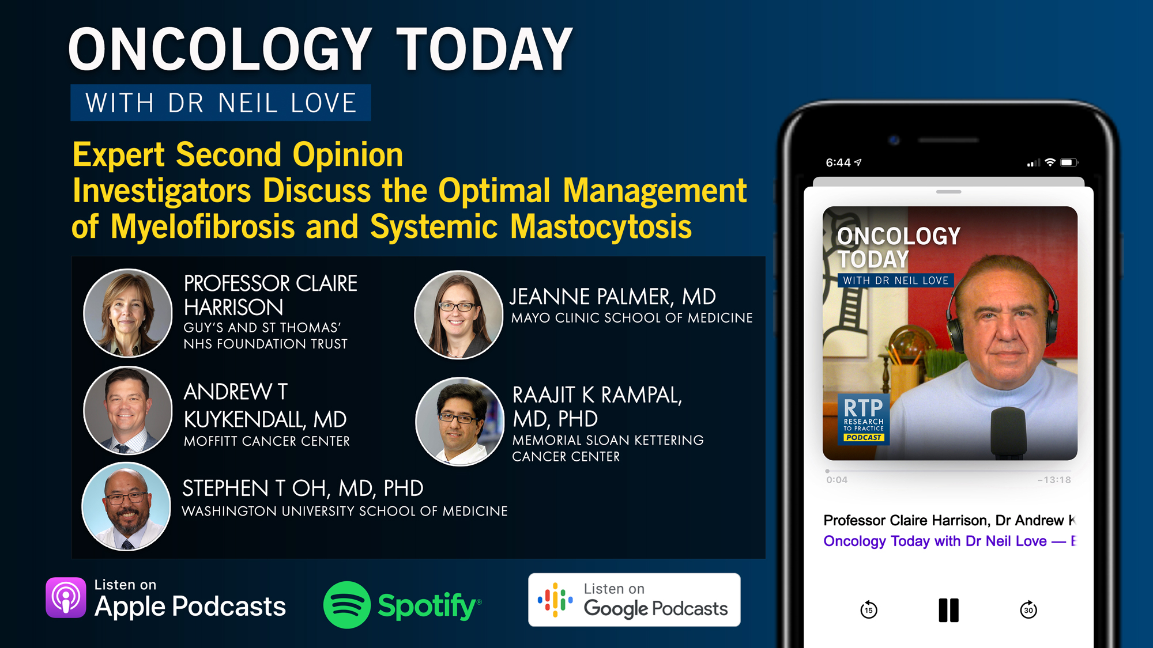

Slide 19
Year in Review: Clinical Investigator Perspectives on the
Most Relevant New Datasets and Advances in Oncology
Novel Treatment Approaches for Non-Hodgkin Lymphoma
A CME/MOC-Accredited Live Webinar
Wednesday, June 17, 2026
5:00 PM – 6:00 PM ET
Faculty
Matthew Matasar, MD
Sonali M Smith, MD
Moderator
Neil Love, MD

Slide 20
Year in Review: Clinical Investigator Perspectives on the
Most Relevant New Datasets and Advances in Oncology
Gastroesophageal Cancers
A CME/MOC-Accredited Live Webinar
Tuesday, June 23, 2026
5:00 PM – 6:00 PM ET
Faculty
David H Ilson, MD, PhD
Kohei Shitara, MD
Moderator
Neil Love, MD

Slide 21
Year in Review: Clinical Investigator Perspectives on the
Most Relevant New Datasets and Advances in Oncology
Multiple Myeloma
A CME/MOC-Accredited Live Webinar
Thursday, June 25, 2026
5:00 PM – 6:00 PM ET
Faculty
Amrita Krishnan, MD
Robert Z Orlowski, MD, PhD
Moderator
Neil Love, MD

Slide 22
Year in Review: Clinical Investigator Perspectives on the
Most Relevant New Datasets and Advances in Oncology
Therapeutic Targets Beyond
EGFR for Non-Small Cell Lung Cancer
A CME/MOC-Accredited Live Webinar
Tuesday, June 30, 2026
5:00 PM – 6:00 PM ET
Faculty
John V Heymach, MD, PhD
Maurice Pérol, MD
Moderator
Neil Love, MD

Slide 23
Grand Rounds
CME/MOC-Accredited Interactive Series
Regional Activities
Three Series
Optimizing Treatment
for Patients with Relapsed/Refractory Chronic Lymphocytic Leukemia
Optimizing the Use of
Novel Therapies for Patients with Diffuse
Large B-Cell Lymphoma
Optimizing Therapy for Patients with Hormone Receptor-Positive
Localized Breast Cancer
Host a 1-hour session at your institution:
Email Meetings@ResearchToPractice.com
or call (800) 233-6153

Slide 24
Thank you for joining us! Please take a moment to complete the survey currently up on Zoom.
Your feedback is very important to us.
Information on how to obtain CME and ABIM MOC credit will be provided at the conclusion of the activity in the Zoom chat room. Attendees will also receive an email in 1 to 3 business days with these instructions.

Slide 25
Consensus or Controversy? Documenting and Discussing
Investigators’ Approaches to the Management of Myelofibrosis
A CME/MOC-Accredited Virtual Event Held
Adjunct with the 2026 ASCO® Annual Meeting
Tuesday, June 2, 2026
5:00 PM – 6:00 PM ET
Faculty
Professor Claire Harrison
Raajit K Rampal, MD, PhD
Moderator
Neil Love, MD

Slide 26
Faculty
Professor Claire Harrison
Professor of Myeloproliferative Neoplasms
Guy’s and St Thomas’ NHS Foundation Trust
London, United Kingdom
MODERATOR
Neil Love, MD
Research To Practice
Miami, Florida
Raajit K Rampal, MD, PhD
Associate Member, Director
MPN and Rare Hematologic Malignancies Program
Director, Center for Hematologic Malignancies
Memorial Sloan Kettering Cancer Center
New York, New York

Slide 27
Contributing Clinical Investigators
Prithviraj Bose, MD
Professor, Department of Leukemia
Co-Leader, Section of Myeloproliferative Neoplasms
Division of Cancer Medicine
The University of Texas MD Anderson Cancer Center
Houston, Texas
John Mascarenhas, MD
Director, Center of Excellence in Blood Cancers and Myeloid Disorders
Director, Adult Leukemia Program
Leader, Myeloproliferative Disorders Clinical Research Program
Division of Hematology/Oncology
Tisch Cancer Institute
Professor of Medicine
Icahn School of Medicine at Mount Sinai
New York, New York
Andrew T Kuykendall, MD
Associate Member, Department of Malignant Hematology
Moffitt Cancer Center
Associate Professor, Department of Oncologic Sciences
University of South Florida
Tampa, Florida
Abdulraheem Yacoub, MD
Professor of Medicine
Clinical Director of Ambulatory
Hematology Clinics
The Division of Hematologic Malignancies
and Cellular Therapeutics (HMCT)
Department of Internal Medicine
The University of Kansas Cancer Center
Fairway, Kansas

Slide 28
We Encourage Clinicians in Practice to Submit Questions
Feel free to submit questions now before the program begins and throughout the program.

Slide 29
Clinicians in the Audience, Please Complete the Pre- and Postmeeting Surveys
Quick Survey
Quick Poll

Slide 31
Year in Review: Clinical Investigator Perspectives on the
Most Relevant New Datasets and Advances in Oncology
Novel Treatment Approaches for Non-Hodgkin Lymphoma
A CME/MOC-Accredited Live Webinar
Wednesday, June 17, 2026
5:00 PM – 6:00 PM ET
Faculty
Matthew Matasar, MD
Sonali M Smith, MD
Moderator
Neil Love, MD

Slide 32
Year in Review: Clinical Investigator Perspectives on the
Most Relevant New Datasets and Advances in Oncology
Gastroesophageal Cancers
A CME/MOC-Accredited Live Webinar
Tuesday, June 23, 2026
5:00 PM – 6:00 PM ET
Faculty
David H Ilson, MD, PhD
Kohei Shitara, MD
Moderator
Neil Love, MD

Slide 33
Year in Review: Clinical Investigator Perspectives on the
Most Relevant New Datasets and Advances in Oncology
Multiple Myeloma
A CME/MOC-Accredited Live Webinar
Thursday, June 25, 2026
5:00 PM – 6:00 PM ET
Faculty
Amrita Krishnan, MD
Robert Z Orlowski, MD, PhD
Moderator
Neil Love, MD

Slide 34
Year in Review: Clinical Investigator Perspectives on the
Most Relevant New Datasets and Advances in Oncology
Therapeutic Targets Beyond
EGFR for Non-Small Cell Lung Cancer
A CME/MOC-Accredited Live Webinar
Tuesday, June 30, 2026
5:00 PM – 6:00 PM ET
Faculty
John V Heymach, MD, PhD
Maurice Pérol, MD
Moderator
Neil Love, MD

Slide 35
Grand Rounds
CME/MOC-Accredited Interactive Series
Regional Activities
Three Series
Optimizing Treatment
for Patients with Relapsed/Refractory Chronic Lymphocytic Leukemia
Optimizing the Use of
Novel Therapies for Patients with Diffuse
Large B-Cell Lymphoma
Optimizing Therapy for Patients with Hormone Receptor-Positive
Localized Breast Cancer
Host a 1-hour session at your institution:
Email Meetings@ResearchToPractice.com
or call (800) 233-6153

Slide 36
Consensus or Controversy? Documenting and Discussing
Investigators’ Approaches to the Management of Myelofibrosis
A CME/MOC-Accredited Virtual Event Held
Adjunct with the 2026 ASCO® Annual Meeting
Tuesday, June 2, 2026
5:00 PM – 6:00 PM ET
Faculty
Professor Claire Harrison
Raajit K Rampal, MD, PhD
Moderator
Neil Love, MD

Slide 37
Prof Harrison— Disclosures
Faculty
Advisory Committees | Alethiomics, AOP Health, Calytrix Bio, Galecto Inc, GSK, Incyte Corporation, Janssen Biotech Inc, Kartos Therapeutics, Karyopharm Therapeutics, Menarini Group, Novartis, Stemline Therapeutics Inc, Takeda Pharmaceutical Company Limited
Consulting Agreements | Alethiomics, AOP Health, Calytrix Bio, Galecto Inc, GSK, Incyte Corporation, Janssen Biotech Inc, Kartos Therapeutics, Karyopharm Therapeutics, Menarini Group, MSD, Novartis, Stemline Therapeutics Inc, Takeda Pharmaceutical Company Limited
Contracted Research | GSK, Novartis
Data and Safety Monitoring Boards/Committees | Deciphera Pharmaceuticals Inc, Silence Therapeutics, Takeda Pharmaceutical Company Limited
Speakers Bureaus | GSK, Menarini Group, MSD, Novartis, Stemline Therapeutics Inc
Nonrelevant Financial Relationships | Owner private LLP, trustee MPN Voice and Blood Cancer UK

Slide 38
Dr Rampal — Disclosures
Faculty
Consulting Agreements | AbbVie Inc, Blueprint Medicines, Bristol Myers Squibb, Cogent Biosciences, CTI BioPharma, a Sobi Company, Disc Medicine, Galecto Inc, GSK, Incyte Corporation, Jazz Pharmaceuticals Inc, Kartos Therapeutics, Karyopharm Therapeutics, MorphoSys, Novartis, Opna Bio, PharmaEssentia, Roche Laboratories Inc, Stemline Therapeutics Inc, Sumitomo Pharma America, Zentalis Pharmaceuticals
Contracted Research | BioMed Valley Discoveries, Incyte Corporation, MorphoSys, Ryvu Therapeutics, Stemline Therapeutics Inc, Zentalis Pharmaceuticals
Data and Safety Monitoring Boards/Committees | Merck

Slide 39
Dr Bose — Disclosures
Contributing Clinical Investigators
Advisory Committees | Blueprint Medicines, Deciphera Pharmaceuticals Inc, Geron Corporation, GSK, Karyopharm Therapeutics, Novartis, PharmaEssentia, RayThera, Sumitomo Pharma America, Takeda Pharmaceuticals USA Inc
Consulting Agreements | Bristol Myers Squibb, Cogent Biosciences, Damora Therapeutics, Disc Medicine, Incyte Corporation, Ionis Pharmaceuticals Inc, Merck, V6, Vyne Therapeutics Inc
Contracted Research | Ajax Therapeutics, Blueprint Medicines, Bristol Myers Squibb, Cogent Biosciences, Disc Medicine, Geron Corporation, GSK, Incyte Corporation, Ionis Pharmaceuticals Inc, Janssen Biotech Inc, Kartos Therapeutics, Karyopharm Therapeutics, Merck, Morphosys, Novartis, Sumitomo Pharma America, Telios Pharma Inc

Slide 40
Dr Kuykendall — Disclosures
Contributing Clinical Investigators
Advisory Committees | AbbVie Inc, Blueprint Medicines, Bristol Myers Squibb, Cogent Biosciences, CTI BioPharma, a Sobi Company, Incyte Corporation, Karyopharm Therapeutics, PharmaEssentia
Consulting Agreements | AbbVie Inc, Karyopharm Therapeutics, MorphoSys
Contracted Research | Blueprint Medicines, Bristol Myers Squibb, Geron Corporation, Janssen Biotech Inc, MorphoSys, Protagonist Therapeutics
Data and Safety Monitoring Boards/Committees | Geron Corporation

Slide 41
Dr Mascarenhas — Disclosures
Contributing Clinical Investigators
Advisory Committees | Cogent Biosciences, Galecto Inc
Consulting Agreements | Blueprint Medicines, Bristol Myers Squibb, Geron Corporation, GSK, Incyte Corporation, Italfarmaco SpA, Karyopharm Therapeutics, Merck, Novartis, Opna Bio, Pfizer Inc, PharmaEssentia, Sobi, Sumitomo Pharma America, Takeda Pharmaceuticals USA Inc
Contracted Research | Ajax Therapeutics, Bristol Myers Squibb, Disc Medicine, Dompé, Geron Corporation, Incyte Corporation, Italfarmaco SpA, Kartos Theraputics, Karyopharm Therapeutics, Novartis, PharmaEssentia, Sobi
Data and Safety Monitoring Boards/Committees | Kartos Theraputics
Stock OPTIONS — Private Companies | Cogent Biosciences

Slide 42
Dr Yacoub — Disclosures
Contributing Clinical Investigators
Consulting Agreements | Blueprint Medicines, GSK, Incyte Corporation, Karyopharm Therapeutics, Novartis, PharmaEssentia, Protagonist Therapeutics, Servier Pharmaceuticals LLC, Takeda Pharmaceuticals USA Inc
Contracted Research | CTI BioPharma, a Sobi Company, Stemline Therapeutics Inc

Slide 43
Dr Love — Disclosures
Dr Love is president and CEO of Research To Practice. Research To Practice receives funds in the form of educational grants to develop CME activities from the following companies: Aadi Bioscience, AbbVie Inc, ADC Therapeutics, Agendia Inc, Alexion Pharmaceuticals, Amgen Inc, Array BioPharma Inc, a subsidiary of Pfizer Inc, Arvinas, Astellas, AstraZeneca Pharmaceuticals LP, Aveo Pharmaceuticals, Bayer HealthCare Pharmaceuticals, BeOne, Biotheranostics Inc, A Hologic Company, Black Diamond Therapeutics Inc, Blueprint Medicines, Boehringer Ingelheim Pharmaceuticals Inc, Bristol Myers Squibb, Celcuity, Clovis Oncology, Coherus BioSciences, Corcept Therapeutics Inc, CTI BioPharma, a Sobi Company, Daiichi Sankyo Inc, Eisai Inc, Elevation Oncology Inc, Exact Sciences Corporation, Exelixis Inc, Genentech, a member of the Roche Group, Genmab US Inc, Geron Corporation, Gilead Sciences Inc, GSK, Helsinn Therapeutics (US) Inc, ImmunoGen Inc, Incyte Corporation, Ipsen Biopharmaceuticals Inc, Jazz Pharmaceuticals Inc, Johnson & Johnson, Karyopharm Therapeutics, Kite, A Gilead Company, Kura Oncology, Legend Biotech, Lilly, MEI Pharma Inc, Merck, Mersana Therapeutics Inc, Mirati Therapeutics Inc, Mural Oncology Inc, Natera Inc, Novartis, Novartis Pharmaceuticals Corporation on behalf of Advanced Accelerator Applications, Novocure Inc, Nuvalent, Nuvation Bio Inc, Pfizer Inc, Pharmacyclics LLC, an AbbVie Company, Puma Biotechnology Inc, Regeneron Pharmaceuticals Inc, Revolution Medicines Inc, Rigel Pharmaceuticals Inc, R-Pharm US, Sanofi, Seagen Inc, Servier Pharmaceuticals LLC, SpringWorks Therapeutics Inc, Stemline Therapeutics Inc, Sumitomo Pharma America, Summit Therapeutics, Syndax Pharmaceuticals, Taiho Oncology Inc, Takeda Pharmaceuticals USA Inc, TerSera Therapeutics LLC, and Tesaro, A GSK Company.

Slide 44
Commercial Support
This activity is supported by educational grants from GSK and Karyopharm Therapeutics.
Research To Practice CME Planning Committee Members,
Staff and Reviewers
Planners, scientific staff and independent reviewers for Research To Practice have no relevant financial relationships to disclose.

Slide 45
This educational activity contains discussion of
non-FDA-approved uses of agents and regimens. Please refer to official prescribing information for each product for approved indications.

Slide 46
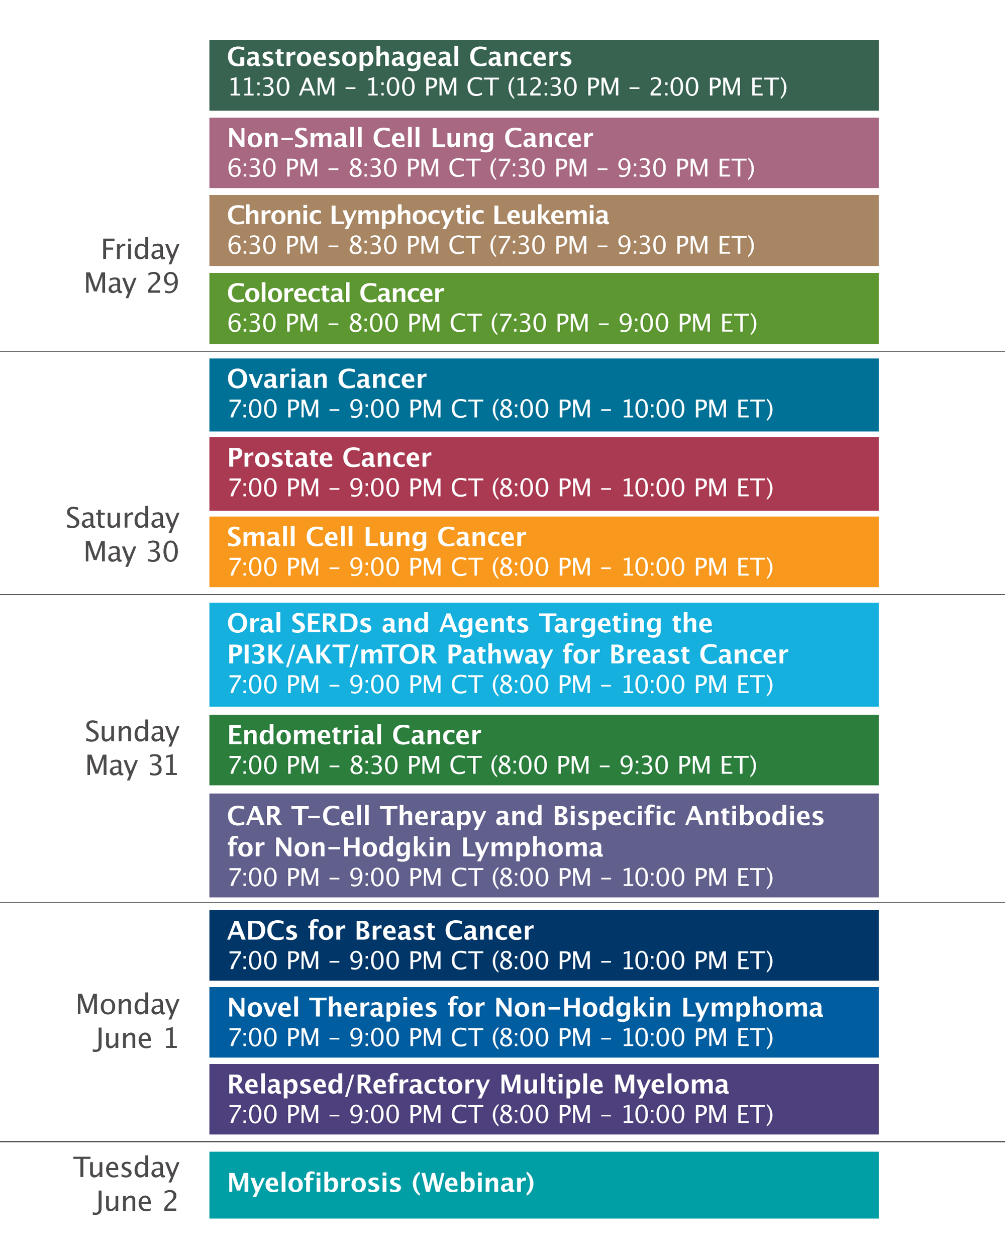

Slide 47
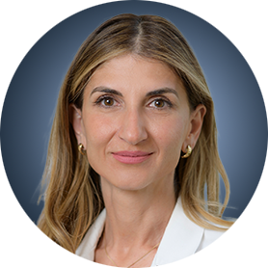


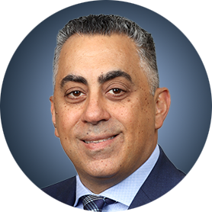
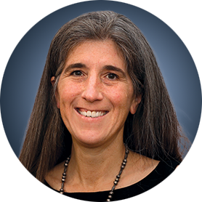
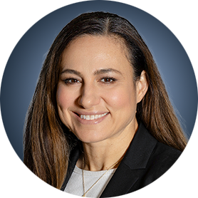



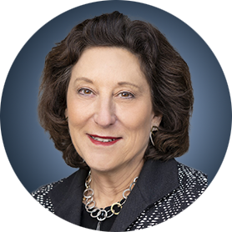

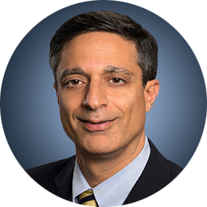
Faculty
Yelena Y Janjigian, MD
Jacob Sands, MD
Jeremy S Abramson, MD, MMSc
Tanios Bekaii-Saab, MD
Kathleen N Moore, MD, MS
Rana R McKay, MD, FASCO
Misty Dawn Shields, MD, PhD
Sara M Tolaney, MD, MPH
Shannon N Westin, MD, MPH, FASCO, FACOG
Hope S Rugo, MD
Brad S Kahl, MD
Sagar Lonial, MD, FACP, FASCO

Slide 48
Agenda
Management of Myelofibrosis (MF)
Introduction: The Biopathophysiology of MF
Module 1: Current and Future Clinical Decision-Making in the Absence of Severe Cytopenias — Prof Harrison
Module 2: Managing MF for Patients with Anemia and Thrombocytopenia —
Dr Rampal
Module 3: Upcoming at EHA 2026

Slide 49
Agenda
Management of Myelofibrosis (MF)
Introduction: The Biopathophysiology of MF
Module 1: Current and Future Clinical Decision-Making in the Absence of Severe Cytopenias — Prof Harrison
Module 2: Managing MF for Patients with Anemia and Thrombocytopenia —
Dr Rampal
Module 3: Upcoming at EHA 2026

Slide 50
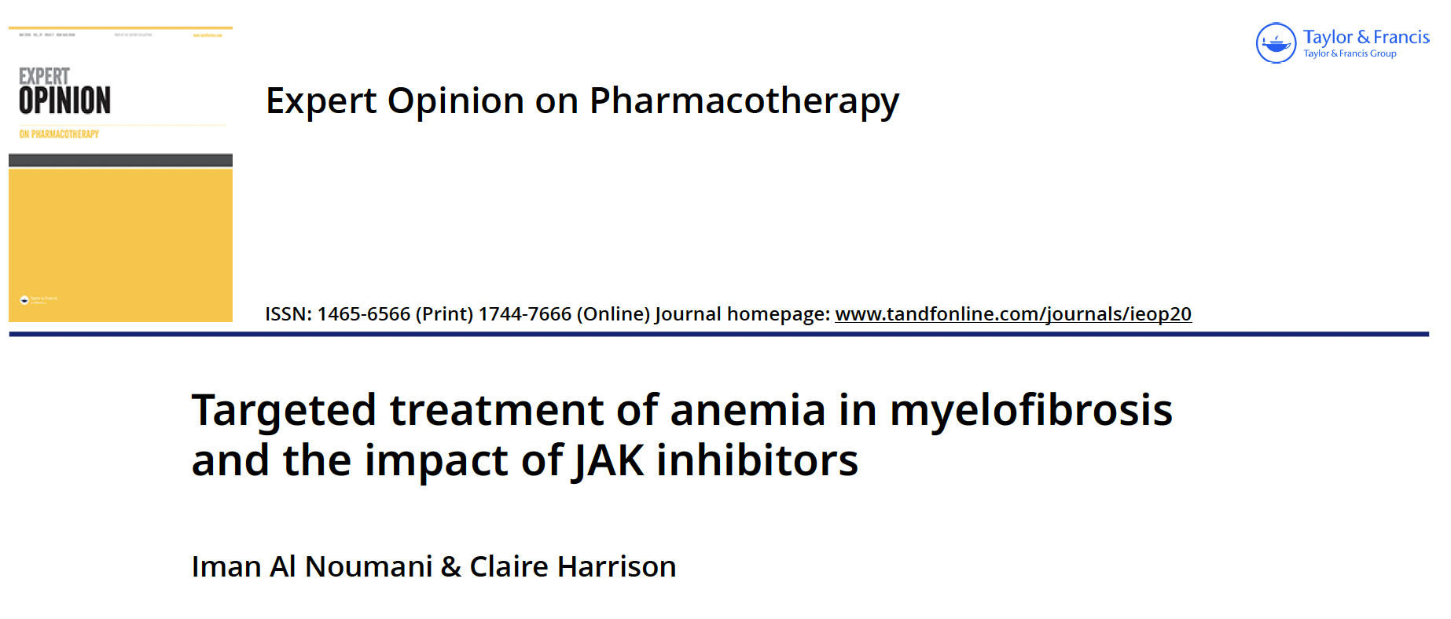
2026 May 12:1-12.

Slide 51
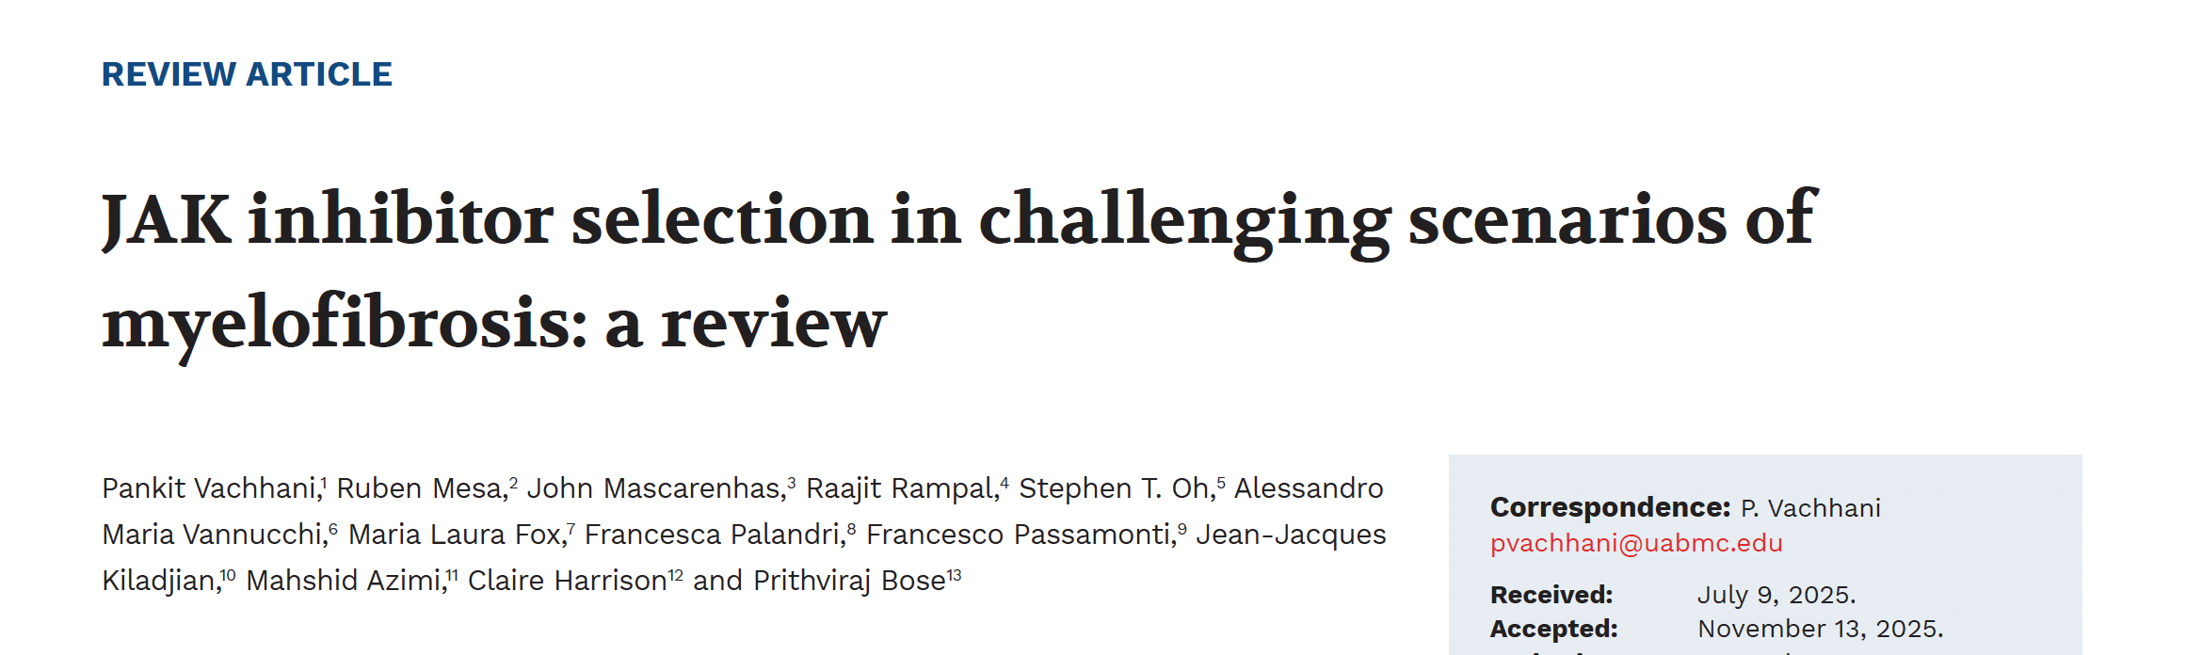
Haematologica 2026;111(4):1179-97.

Slide 52
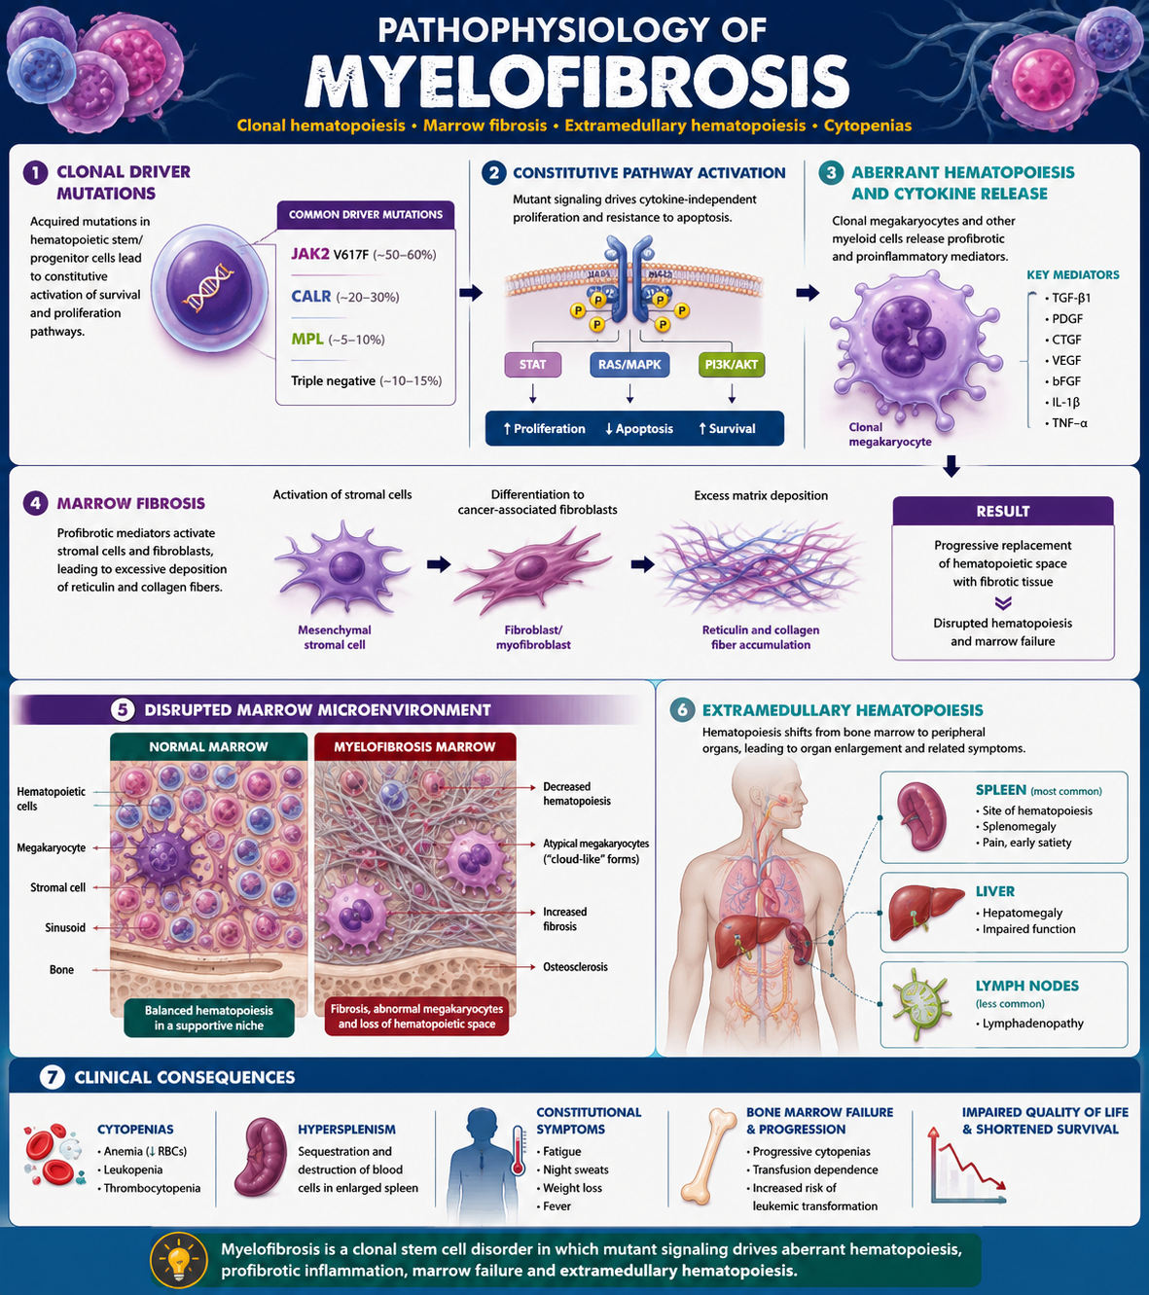
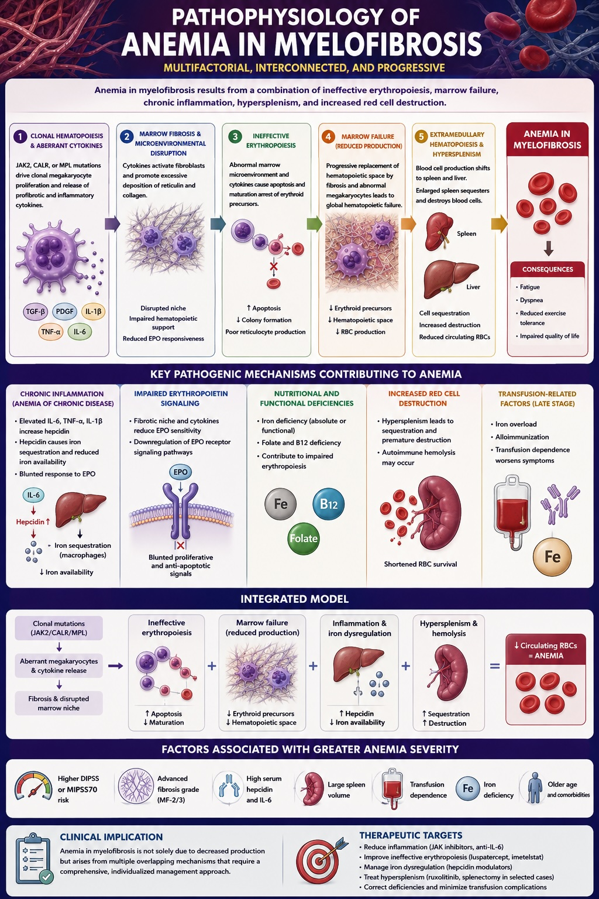

Slide 53
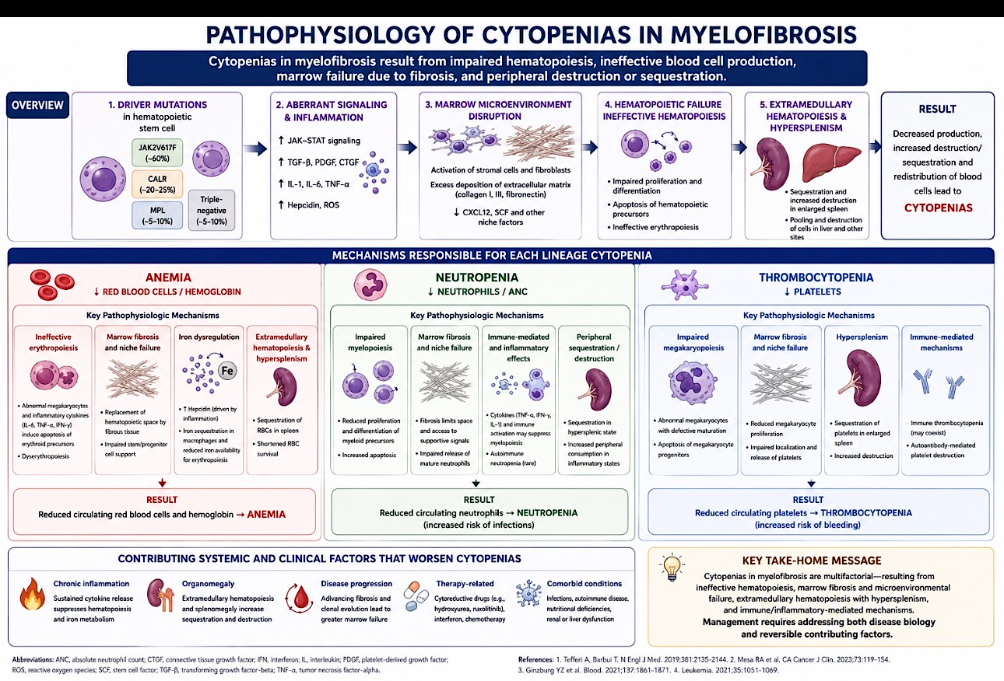

Slide 55
Agenda
Management of Myelofibrosis (MF)
Introduction: The Biopathophysiology of MF
Module 1: Current and Future Clinical Decision-Making in the Absence of Severe Cytopenias — Prof Harrison
Module 2: Managing MF for Patients with Anemia and Thrombocytopenia —
Dr Rampal
Module 3: Upcoming at EHA 2026

Slide 56
What is your threshold (in terms of symptom burden, degree of splenomegaly, etc) for initiating active treatment for patients with low-risk MF?
Splenomegaly – symptomatic or progressive
>2-3 cm increase, rising WBC and thrombocytosis
Constitutional symptoms +/- symptomatic splenomegaly
Any symptoms
Significant symptom burden or symptomatic splenomegaly
If MPN-related symptoms are clear and bothersome or spleen >5-10 cm
Presence of true B symptoms
MPN = myeloproliferative neoplasm

Slide 57
In which situations, if any, will you initiate active treatment for a patient with MF who is asymptomatic?
Increasing splenomegaly, WBC, LDH or blasts, decreasing Hb
Massive splenomegaly
Increasing splenomegaly
Splenomegaly >20 cm
Splenomegaly >20 cm
Low risk clinically and high risk by molecular models

Slide 58
If a patient with treatment-naïve MF were to ask you to estimate the likelihood that they would achieve meaningful clinical benefit with ruxolitinib, how would you respond?
If there was an indication to use I would say
97% have an initial reduction in spleen size
>80%
90%
Most patients treated with ruxolitinib experience benefit in terms of spleen size reduction and improvement in symptoms
Very high
Patients with good initial response who can tolerate
therapy will likely have a longer response

Slide 59
What starting dose and schedule of ruxolitinib would you typically use for the patient below with MF and a platelet count >200,000/μL?
Otherwise healthy 65-year-old
Frail 80-year-old
20 mg BID
Maybe 10 mg BID (depending on Hb)
20 mg BID
5 mg BID
20 mg BID
20 mg BID
20 mg BID
15 mg BID
15 mg BID
10 mg BID
15 mg BID
10 mg BID

Slide 60
What is the highest dose of ruxolitinib you would employ for a patient whose disease is not responding or suboptimally responding?
25 mg BID
25 mg BID
25 mg BID
25 mg BID
25 mg BID
25 mg BID

Slide 61
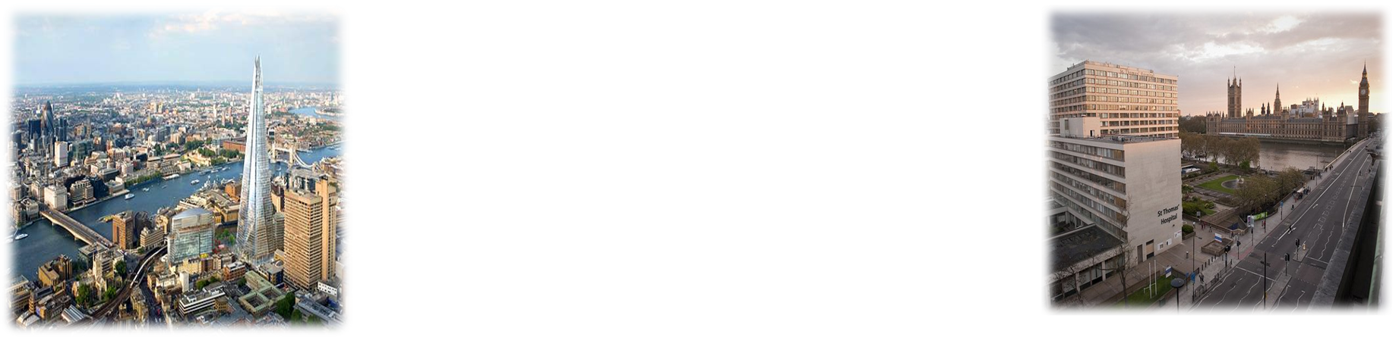


Biology of Myelofibrosis (MF):
Current and Future Clinical Decision-Making in the Absence of Severe Cytopenias
Claire.Harrison18@nhs.net

Slide 62




MF burden is driven by splenomegaly, bone marrow fibrosis and cytopenias
Splenomegaly¹
The revised 2022 ICC diagnostic criteria for MF include palpable splenomegaly as a minor criteria
MF-related symptoms¹⁻³
Surveys of patients with MF suggest that >80% were experiencing ≥1 disease-related symptom at the time of the survey⁴
Weight loss
Fatigue
Night sweats
Itching
Fever
Burdensome symptoms negatively affect the quality of life of patients²
Bone pain
Bone marrow fibrosis^{1,5}
Progressive bone marrow fibrosis leads to a myelophthisic
phenotype with worsening cytopenias, which can lead to bone pain
Cytopenia¹
At diagnosis, roughly 40% of patients have
Hb <10 g/dL, and over 20% are already
RBC transfusion-dependent
Anaemia
Thrombocytopenia

Slide 63

Current treatment goals do not adequately address the underlying MF disease biology
Current MF treatment goals include:¹
JAKi, the cornerstone of MF therapy, reduce symptoms and splenomegaly, and modestly improve survival^{2–4}
Reduction in splenomegaly
These treatments do not consistently resolve pathobiological features of MF and may not adequately address the underlying
disease biology^{2,5}
Improved survival
Reduction in symptoms
An unmet need remains due to the limited depth and durability of clinical response and frequency of TEAEs with JAKi monotherapy⁵
Prevention
of disease progression
Reduction in thrombotic/ haemorrhagic events

Slide 64
Despite treatment advances for MF, an unmet need remains
JAKi predominantly alleviates splenomegaly and MF-associated symptoms, with modest survival benefit, but has limited impact on disease progression and underlying disease biology
Treatment options remain limited and HSCT, the only curative approach, is available to a minority of patients with high or very high-risk MF
There is a need for novel agents that offer the potential for disease modification
to improve clinical outcomes

Slide 65

Addressing the limitations of JAKi monotherapy in MF
MF
JAKi
MF is a complex disease, and current therapies do not adequately address the underlying disease biology^{1,2}
JAKi monotherapy is associated with limited depth and durability of clinical response²
Early JAKi initiation for patients with intermediate-2 and high-risk MF improves clinical outcomes, including fewer cytopenias, durable SVR and prolonged OS³
Novel or combination
first-line strategies could improve the current treatment paradigm⁴
Early intervention
New strategies

Slide 66
Early treatment in MF may improve clinical outcomes including prolonged overall survival
In a pooled analysis of COMFORT-I and COMFORT-II, early RUX initiation within 1 year of diagnosis was associated with improved spleen and symptom responses and prolonged survival
At RUX initiation, spleen responses were more durable among those with a disease duration ≤12 months vs
>12 months
Spleen and symptom responses by disease duration at RUX initiation
OS of patients by disease duration at RUX initiation
1.0
Disease duration at RUX initiation
0.9
0.8
0.7
0.6
0.5
0.4
0.3
0.2
Patients, n
RUX ≤12 months
RUX >12 months
PBO/BAT ≤12 months
PBO/BAT >12 months
Events, n (%)
84
216
66
159
0.1
Censored, n (%)
29 (34.5)
99 (45.8)
31 (47.0)
86 (54.1)
240-week survival (95% CI)
55 (65.5)
117 (54.2)
35 (53.0)
73 (45.9)
0.0
0.633 (0.514–0.730)
0.568 (0.494–0.635)
0.494 (0.357–0.617)
0.407 (0.323–0.488)
0
24
48
72
96
120
144
168
192
216
240
264
Number of patients at risk:
Time to Death, week
84
82
78
74
70
67
66
55
55
50
46
37
216
206
188
169
153
148
137
124
115
111
99
75
66
63
54
50
47
42
37
33
29
24
22
17
159
148
123
111
98
85
78
73
62
56
50
42

Slide 67
Many patients experience inadequate response with JAKi monotherapy
1L 'failure' and its subcategories
Primary resistance
Primary refractory | Absence of onset of any clinical response within 28 days of starting treatment
Lack of response | Failure to achieve a >CI (e.g., spleen or symptom response) within 12 weeks of starting
“Mixed response” | AEs (e.g., cytopenias) complicate CI or better clinical response
Secondary resistance
Relapse/loss of response | <CI after reaching CI/PR/CR or loss of anaemia or spleen responses persisting for ≥1 month (IWG-MRT/ELN)
and/or disease progression | e.g., worsening leukocytosis, thrombocytopenia, anaemia, increase in circulating blasts
Intolerance
Patients have dose reductions or interruptions due to development or exacerbation of cytopenias

Slide 68
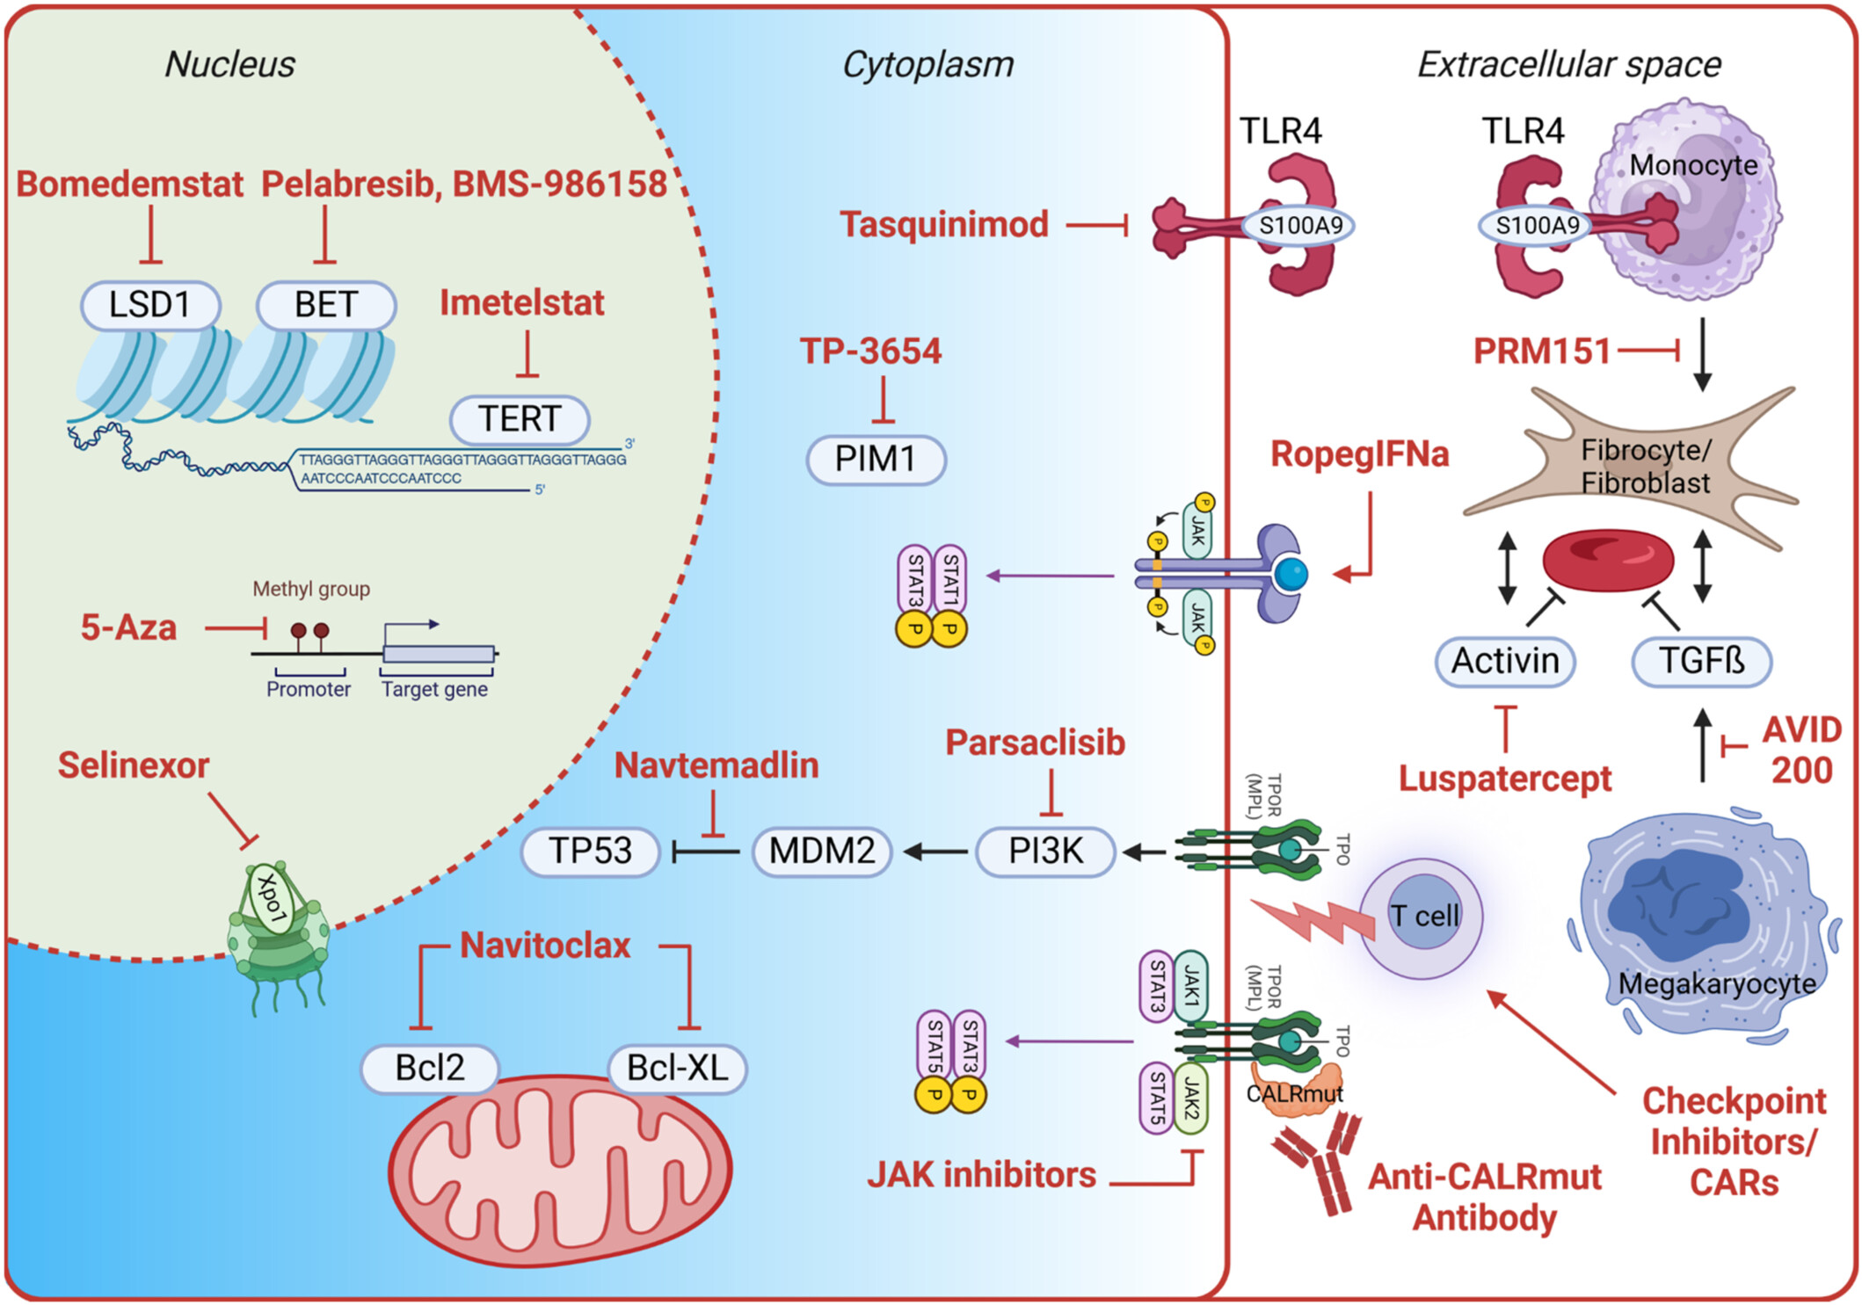
New targets beyond JAK-STAT could enable opportunities for combination strategies
Targets beyond the JAK-STAT pathway³
Resistance may occur due to the activation of non-JAK-STAT pathways^{1,2}
Targets of novel therapeutics in MF in clinical development include:²
    Epigenetics
    Apoptosis
    Telomerase
    Intracellular signaling pathways

Slide 69
JAKi combination approaches are being explored to address unmet needs – Phase 3 trials
Drug | Trials | Mechanism of action | Latest phase in MF | Line of treatment | Active Phase 3 MF clinical trials,* n
Therapies in development for MF
Pelabresib^{1,2} | MANIFEST (Phase 2) MANIFEST-2 (Phase 3) | BET inhibitor | Phase 3 | JAKi-naive, in combination with RUX | 1
Imetelstat^{3,4} | IMproveMF (Phase 1/1b) IMbark (Phase 2) IMpactMF (Phase 3) | Telomerase inhibitor | Phase 3 | Relapsed/refractory to JAKi treatment | 1
Luspatercept⁵⁻⁷ | ACE-536-MF-001 (Phase 2) INDEPENDENCE (Phase 3) | TGF-β inhibitor | Phase 3 | Patients with anaemia and require red blood cell transfusions on concomitant JAKi treatment | 1
Navtemadlin^{8,9} | KRT-232-109 (Phase 1/2) POEISIS (Phase 3) BOREAS (Phase 2/3) | MDM2 inhibitor | Phase 3 | JAKi-naive with suboptimal response to RUX, as add-on to RUX Relapsed/refractory to JAKi | 2
Selinexor¹⁰ | SENTRY-2 (Phase 2) SENTRY (Phase 3) | XPO1 inhibitor | Phase 3 | JAKi-naive, in combination with RUX | 1

Slide 70
Phase 3 MANIFEST-2 study evaluates pelabresib + RUX in patients who are JAKi-naïve
Global, randomized, double-blind, active-controlled, Phase 3 trial^{1,2}
Study population¹
Treatment arms¹
JAKi-naive patients with myelofibrosis (N=430)
(primary or post-ET/PV)
DIPSS Int-1 risk or higher
Spleen volume (≥450 cm³)
Platelet count ≥100 × 10⁹/L²
TSS ≥10 (≥3 for two symptoms, MFSAF v4.0)
Peripheral blast count <5%
ECOG PS ≤2
Pelabresib
125 mg* PO QD
Day 1–14
RUX
Per label with a 5 mg BID lower starting dose†
Day 1–21
Primary endpoint¹
SVR35 response at week 24
Key secondary endpoints¹
Absolute change in TSS from
baseline at week 24
TSS50 response at week 24
Safety¹
AEs of all grades and serious AEs
+
Double-blind
randomization¹
(1:1)
Placebo
PO QD
Day 1–14
RUX
Per label with a 5 mg BID lower starting dose†
Day 1–21
+
1:1 randomization stratified by:¹
DIPSS risk category: Int-1 vs Int-2 vs high
Platelet count: >200 × 10⁹/L vs 100–200 × 10⁹/L
Spleen volume: ≥1800 cm³ vs <1800 cm³

Slide 71
Significant reduction in spleen volume was demonstrated in MANIFEST-2 at week 24 and sustained at week 96
Phase 3 MANIFEST-2 primary endpoint
Week 24
Week 96
100
Evaluable patients:
PELA+RUX (n=170)
PBO+RUX (n=182)
Evaluable patients:
PELA+RUX (n=106)
PBO+RUX (n=113)
25
50
0
Percent change from baseline (%)
– 25
Percent change from baseline (%)
0
– 35%
– 35%
– 50
– 50
– 75
 | PELA+RUX (N=214) | PBO+RUX (N=216)
SVR35 response at week 24 in evaluable patients | 82.9% (141/170) | 41.8% (76/182)
Difference | 41.1%
SVR35 response at week 24 in ITT population | 65.9% (141/214) | 35.2% (76/216)
Difference | 30.4% (21.6-39.3)
 | PELA+RUX (N=214) | PBO+RUX (N=216)
SVR35 response at week 96 in evaluable patients | 91.5% (97/106) | 57.5% (65/113)
Difference | 34.0%
SVR35 response at week 96 in ITT population | 45.3% (97/214) | 30.1% (65/216)
Difference | 14.9% (6.1-23.8)

Slide 72
In MANIFEST-2, improvements in absolute TSS at week 24 were sustained through week 96
Week 24
Week 96
Evaluable patients:
PELA+RUX (n=181)
PBO+RUX (n=175)
Evaluable patients:
PELA+RUX (n=100)
PBO+RUX (n=106)
20
20
0
0
0
0
Absolute change from baseline
Absolute change from baseline
– 20
– 20
– 40
– 40
– 60
– 60
 | PELA+RUX (N=214) | PBO+RUX (N=216)
TSS change from baseline at Week 24 in the ITT population, LSM | -15.08 | -13.12
Difference (95% CI) | -1.96 (-4.11, 0.18)
 | PELA+RUX (N=214) | PBO+RUX (N=216)
TSS change from baseline at Week 96 in the ITT population, LSM | -15.07 | -12.48
Difference (95% CI) | -2.59 (-5.23, 0.05)

Slide 73
Phase 2 IMbark study evaluates imetelstat in patients with R/R MF
Single-blind, randomised study to assess the efficacy and safety of two doses of imetelstat
Treatment arms
Study population
Patients with MF who are R/R to JAK inhibitors (N=107)
DIPSS Int-2 risk or high-risk
Measurable splenomegaly
Active symptoms of MF
ECOG PS ≤2
Imetelstat
9.4 mg/kg
2-hr intravenous infusion
Co-primary endpoint
SVR35 and symptom response at week 24
Secondary endpoints
OS
Clinical improvement per modified 2013 IWG-MRT
Safety
Single-blind
randomisation*
(1:1)
21-day cycles
Imetelstat
4.7 mg/kg
2-hr intravenous infusion
1:1 randomisation stratified by:
Palpable spleen size ≥15 cm (yes vs no)
Platelet count (≥75 x 10⁹/L and <150 x 10⁹/L vs ≥150 x 10⁹/L)
The Phase 3 study of imetelstat is ongoing

Slide 74
Greater spleen and symptom responses were seen with a higher dose of imetelstat in the IMbark study
Phase 2 IMbark co-primary endpoints
Spleen response (SVR) at week 24
Symptom response (TSS50) at week 24
Spleen response | 4.7 mg/kg (n=48) | 9.4 mg/kg (n=59)
≥10% SVR, n (%) | 4 (8.3) | 22 (37.3)
≥20% SVR, n (%) | 1 (2.1) | 13 (22)
≥30% SVR, n (%) | 0 | 6 (10.2)
Symptom response | 4.7 mg/kg (n=48) | 9.4 mg/kg (n=59)
≥50% TSS reduction, n (%) | 3 (6.3) | 19 (32.2)
An imetelstat dose of 9.4 mg/kg demonstrated clinical benefit in patients with MF who are R/R to JAKi treatment

Slide 75




Selinexor is an investigational, targeted, oral XPO1 inhibitor
XPO1 inhibition is a fundamental mechanism of action that may target both JAK/STAT and non-JAK/STAT pathways in MF
Selinexor inhibits XPO1-mediated nuclear cargo protein export that may lead to:
Increased malignant cell death¹
Reduced inflammation²
Apoptosis of JAK2-mutated MF CD34+ cells but not healthy donor cells³
Synergism with ruxolitinib and other therapeutic agents in cell lines with or without JAK2^{V617F} and TP53 mutations⁴
JAK/STAT pathway inhibition
↓ STAT phosphorylation
and protein levels^{5,6}
↓ AKT and mTOR^{5,7,8}
p53-driven cell death¹
↓ p53 nuclear export
↑ p53 nuclear localization
and activity
Cytoplasm
XPO1
Selinexor
NF-κB pathway inhibition
↓ IKK phosphorylation²
↓ Cytokine production²
↑ Nuclear IκBα^{2,8,9}
Nucleus
Cell cycle arrest
↑ p21 and p27^{8,10}
↓ CDC25A^{8,11}
↓ CDK4/6^{8,12}
↑ G0/G1 arrest^{8,10,12}
IκBα, inhibitor of nuclear factor kappa-B kinase subunit alpha; IKK, IκB kinase complex; JAK 2, janus kinase 2; JAK/STAT, janus kinase/signal transducer and activator of transcription;
MF, myelofibrosis; mTOR, mammalian target of rapamycin; NF-κB, nuclear factor κB; STAT, signal transducer and activator of transcription; XPO1, exportin 1. 1. Yan D, et al. Clin Cancer Res 2019;25:2323–35; 2. Kashyap T, et al. Oncotarget 2016;7:78883–895; 3. Lu M, et al. Abstract #1792; poster at ASH 2023; San Diego, CA. 4. Maloof M, et al. Poster presented at: 15th International Congress for Myeloproliferative Neoplasms (MPN); November 2–3, 2023; Brooklyn, NY;
5. Walker CJ, et al. Blood 2013;122:3034–44; 6. Cheng Y, et al. Mol Cancer Ther 2014;13:675–86; 7. Argueta C, et al. Oncotarget. 2018;9;25529–44; 8. Gandhi UH, et al. Clin Lymphoma Myeloma Leuk 2018;18:335–45;
9. Turner JG, et al. Oncotarget 2016;7:78896–909; 10. Gravina GL, et al. BMC Cancer 2015;15:941; 11. Garg M, et al. Oncotarget 2017;8:7521–32; 12. Tan M, et al. Am J Physiol Renal Physiol 2014;307:F1179–86.

Slide 76
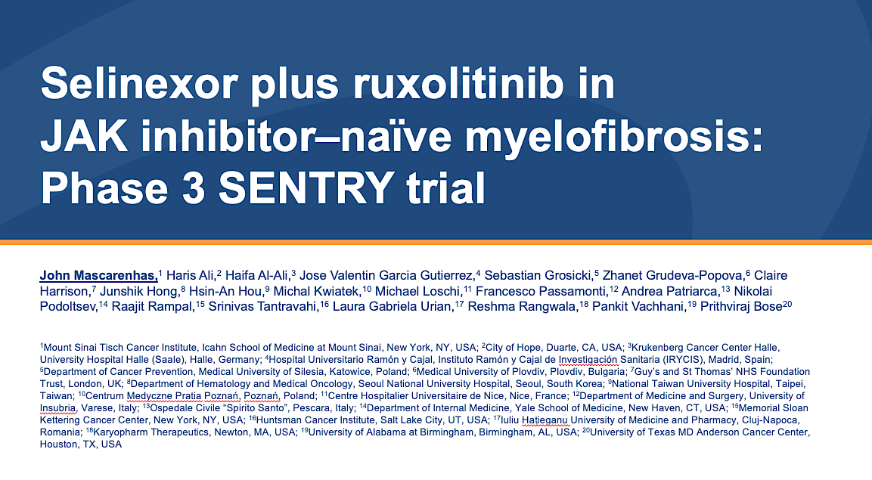
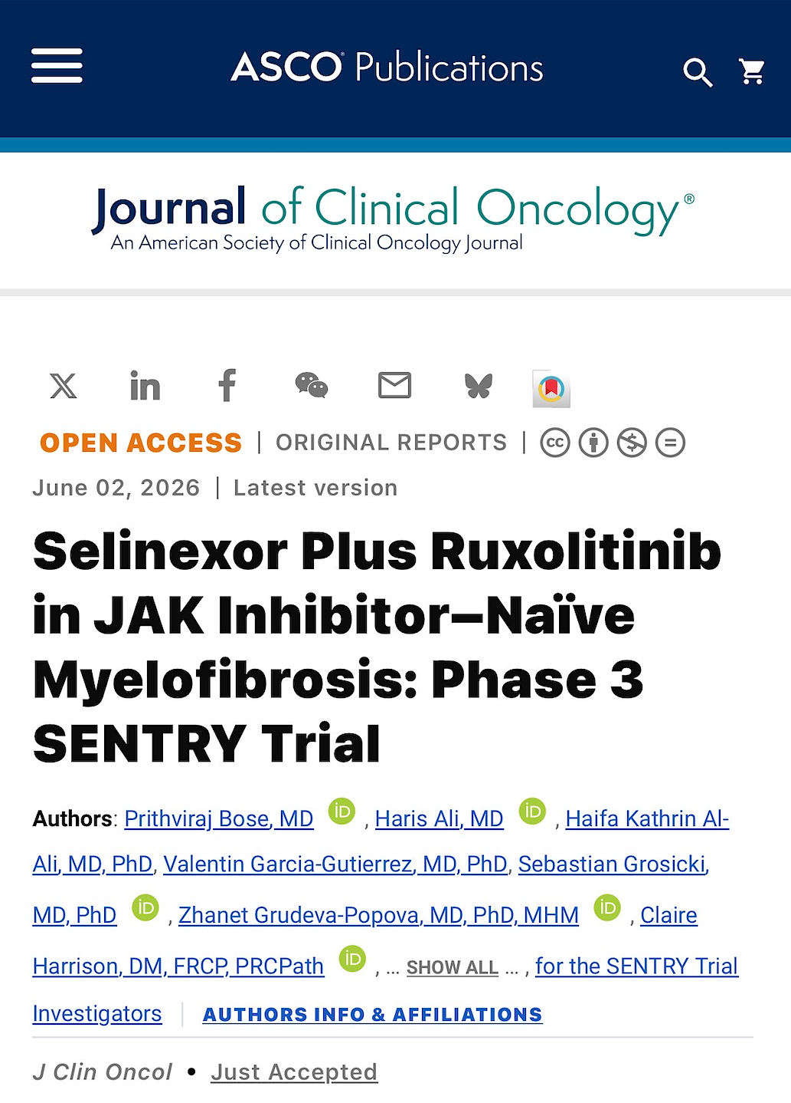
ASCO 2026;Abstract LBA6500

Slide 77
Phase 3 SENTRY study evaluates selinexor + RUX in patients who are JAKi-naïve
Double-blind, placebo-controlled, randomised study to assess the efficacy and safety of selinexor + RUX vs placebo + RUX^{1,2}
Treatment arms^{1,2}
Study population^{1,2}
Co-primary endpoint^{1,2}
SVR35 and absolute mean change in TSS at week 24
Secondary endpoints^{1,2}
Safety and tolerability¹
OS and PFS^{1,2}
SVR35 and absolute mean change in TSS at week 48 and anytime¹
Duration of SVR response¹
Pharmacokinetics¹
Selinexor
60 mg oral tablet QW
days 1, 8, 15, 22
RUX
15 or 20 mg BID starting dose based on baseline platelet count
Adults with JAKi-naive MF (N=353)^{1,2}
DIPSS Int-1 with symptoms, Int-2 or high-risk¹
Measurable splenomegaly¹
Active symptoms of MF¹
ECOG PS ≤2¹
+
Double-blind
randomisation
(2:1) with stratification¹
28-day cycles
Placebo
60 mg oral tablet QW
days 1, 8, 15, 22
RUX
15 or 20 mg BID starting dose based on baseline platelet count
+
Stratified by:¹
DIPSS: Int-1 vs Int-2 or high risk
Spleen volume: <1800 cm³ vs >1800 cm
Baseline platelet counts: 100–200 x 10⁹/L vs >200 x10⁹/L

Slide 78
Significantly higher SVR35 at Week 24 with selinexor + ruxolitinib vs ruxolitinib alone
Difference: 21.8%
(OR 2.58; 95% CI: 1.60, 4.17) One-sided P < 0.0001
60
50
40
30
20
10
0
Change from baseline in spleen volume (Week 24), %
SVR35 at Week 24, %
−10
−20
−30
−40
SVR35 threshold
−50
−60
−70
−80
−90
Selinexor + ruxolitinib
Placebo + ruxolitinib
Data cut off: February 20, 2026.
*Cochran-Mantel-Haenszel test stratified by randomization factors.
Placebo arm scaled 2:1 to compensate for randomization ratio.
CI: confidence interval; OR: odds ratio; SD: standard deviation; SVR35: spleen volume reduction of at least 35% from baseline.
ASCO 2026;Abstract LBA6500.

Slide 79
Rapid, deep, and sustained spleen volume reduction with selinexor + ruxolitinib vs ruxolitinib alone
Percent change from baseline in spleen volume over time
SVR35 rates over time
10
SVR35* | Selinexor + ruxolitinib (N = 235) | Placebo + ruxolitinib (N = 118)
Week 12, n (%) | 116 (49.4) | 24 (20.3)
Week 24, n (%) | 117 (49.8) | 33 (28.0)
Week 36, n/n1† (%) | 97/207 (46.9) | 23/100 (23.0)
At any time, n (%) | 159 (67.7) | 53 (44.9)
 | OR 2.59 (95% CI: 1.64, 4.10) Nominal P < 0.0001
0
−10
−20
Percent change from baseline in spleen volume over time, mean (SD)
−30
−40
−50
−60
−70
−80
Baseline
Week 12
Week 24
Week 36
Week 48
Selinexor + ruxolitinib
Placebo + ruxolitinib
235
118
199
102
186
98
134
76
94
53
Not all patients have been followed beyond Week 24
Data cut off: February 20, 2026.
*SVR35 at any time defined as proportion of patients with SVR35 to any post-baseline assessment regardless of visit window before any new anti-MF therapy or disease progression.
†n1 = number of patients who completed spleen assessment or discontinued the study prior to the specific timepoint.
CI: confidence interval; MF: myelofibrosis; OR: odds ratio; SD: standard deviation; SVR35: spleen volume reduction of at least 35% from baseline.
ASCO 2026;Abstract LBA6500.

Slide 80
No difference in AbsTSS between treatment arms at Week 24
Both arms demonstrated similar improvement in symptoms
TSS | Selinexor + ruxolitinib (N = 235) | Placebo + ruxolitinib (N = 118)
Change in absolute TSS at Week 24 Estimated mean (95% CI) | -9.9 (-11.2, -8.6) | -10.9 (-12.6, -9.1)
Adjusted mean difference (95% CI) | 0.97 (-1.07, 3.02); one-sided P = 0.825
Mean change from baseline in TSS
Estimated mean (95% CI)
Reductions in TSS were consistent across symptom domains
Data cut off: February 20, 2026.
Adjusted absolute mean change from baseline, adjusted mean difference, 95% CI, and one-sided P-value are based on mixed-effects model for repeated measures adjusted for randomization stratification factors and baseline TSS.
AbsTSS; absolute total symptom score; CI: confidence interval; TSS: total symptom score.
ASCO 2026;Abstract LBA6500.

Slide 81
Meaningful overall survival with selinexor + ruxolitinib vs ruxolitinib alone
1.00
Deaths | Selinexor + ruxolitinib (N = 235) | Placebo + ruxolitinib (N = 118)
Primary cause of death, n (%)
Disease progression | 3 (1.3) | 3 (2.5)
Adverse event | 3 (1.3) | 5 (4.2)
Other | 5 (2.1) | 1 (0.8)
Unknown | 0 | 3 (2.5)
0.75
Probability of survival
0.50
Events: 11 (4.7%) vs 12 (10.2%)
Median follow-up: 11.6 vs 12.6 months
HR 0.43 (95% CI: 0.19, 1.00); nominal one-sided P = 0.022
0.25
0.00
+ Censored
0
1
2
3
4
5
6
7
8
9
10
11
12
13
14
15
16
17
18
19
20
21
22
23
24
25
Months
Number at risk
Selinexor + Ruxolitinib
235
230
222
220
218
215
205
187
168
153
140
123
109
96
84
70
63
48
37
30
19
9
2
0
Placebo + Ruxolitinib
118
115
114
114
114
113
111
101
96
86
71
59
54
50
40
33
27
21
18
15
11
4
2
1
1
0
Data cut off: February 20, 2026.
OS is defined as the duration from date of randomization to date of death due to any cause. Follow-up time based on reverse Kaplan-Meier method by swapping the censoring status. OS analysis stratified by the randomization stratification factors. Hazard ratio based on Cox Proportional Hazard model with Efron's method of handling ties.
CI: confidence interval; HR: hazard ratio; OS: overall survival.
ASCO 2026;Abstract LBA6500.

Slide 82
SVR35 at Week 24 predicted overall survival irrespective of treatment
Landmark analysis at Week 24
1.00
0.75
Probability of survival
0.50
98% of SVR35 responders vs 88% of nonresponders were alive at Week 72
0.25
0.00
+ Censored
0
3
6
9
12
15
18
Time beyond Week 24, months
Number at risk
SVR35 at Week 24
150
126
89
68
37
12
0
No SVR35 at Week 24
180
141
99
62
35
18
2
Data cut off: February 20, 2026.
SVR35: spleen volume reduction of at least 35% from baseline.
ASCO 2026;Abstract LBA6500.

Slide 83
Treatment-emergent adverse events
Selinexor + ruxolitinib
(N = 234*)
Placebo + ruxolitinib
(N = 116*)
Transformation to acute myeloid leukemia was rare and equivalent between arms (1.7% each)
Anemia
57%
37%
32%
58%
Thrombocytopenia
59%
18%
3%
43%
Nausea
57%
7%
1%
17%
Constipation
32%
1%
36%
Fatigue
26%
6%
2%
16%
Neutropenia
27%
16%
7%
9%
Diarrhea
22%
1%
1%
15%
Dizziness
19%
1%
9%
Upper respiratory tract infection
15%
14%
Asthenia
16%
2%
9%
Abdominal pain
15%
1%
1%
7%
Alanine aminotransferase increased
11%
3%
1%
13%
Aspartate aminotransferase increased
11%
2%
12%
Decreased appetite
15%
2%
3%
Headache
12%
8%
Vomiting
12%
1%
5%
Pyrexia
7%
1%
12%
Any Grade (≥10%)
Dysgeusia
10%
1%
1%
Grade ≥3
Pain in extremity
4%
2%
10%
60
50
40
30
20
10
0
10
20
30
40
50
60
Patients, %
% of selinexor + ruxolitinib patients who experienced nausea drops from 35% at Wks 1-4 to 5% at Wks 21-24
Data cut off: February 20, 2026.
*Three patients total did not receive treatment (n = 1, selinexor; n = 2, placebo) and were excluded from this analysis.
ASCO 2026;Abstract LBA6500.

Slide 84
Phase 3 BOREAS study evaluates navtemadlin vs BAT* in patients with R/R MF
Randomised, controlled, open-label study to assess the efficacy and safety of navtemadlin vs BAT^{1,2}
Study population¹⁻³
Treatment arms¹⁻³
Adults with TP53^{WT} MF who are R/R to JAKi (N=282)¹
Confirmed diagnosis of PMF, post-PV or post-ET MF¹⁻³
Failure of prior JAKi treatment¹⁻³
DIPSS Int-1, Int-2 or high-risk²
ECOG PS ≤2^{1,2}
Navtemadlin (n=188)¹
240 mg oral QD
7 days on, 21 days off
Primary endpoint¹⁻³
SVR35 at week 24
Key secondary endpoints¹⁻³
TSS50 at week 24¹⁻³
OS and PFS¹⁻³
Overall SVR35 any time¹⁻³
Duration of SVR response^{1,3}
RBC transfusion independence at week 24^{1,3}
Safety^{1,3}
Double-blind
randomisation
(2:1) with stratification¹
28-day cycles
BAT* (n=94)¹
7 days on, 21 days off
Stratified by:¹
MF type (primary vs secondary [post-PV or post-ET])
Baseline TSS ( ≤10 v <10)

Slide 85
Navtemadlin monotherapy led to a greater spleen response compared with BAT* at week 24 in BOREAS
Phase 3 BOREAS study primary endpoint
Spleen response at week 24 (ITT population)
Response | Navtemadlin (n=123) | BAT* (n=60)
Patients achieving SVR35, no (%) | 18 (15) | 3 (5)
Navtemadlin being tested in the on-going POEISIS trial

Slide 86
Emerging therapies and combinations are shaping the future of MF treatment
Early intervention may improve clinical outcomes, including survival; however, some patients may still experience inadequate response
Combination strategies with JAKi and emerging agents such as pelabresib, imetelstat, luspatercept, navtemadlin and selinexor are being explored in Phase 3 studies
  Mutation targeted therapies are also of great interest in the management of MF

Slide 87

Emerging Therapies
Gotlib 2026

Slide 88
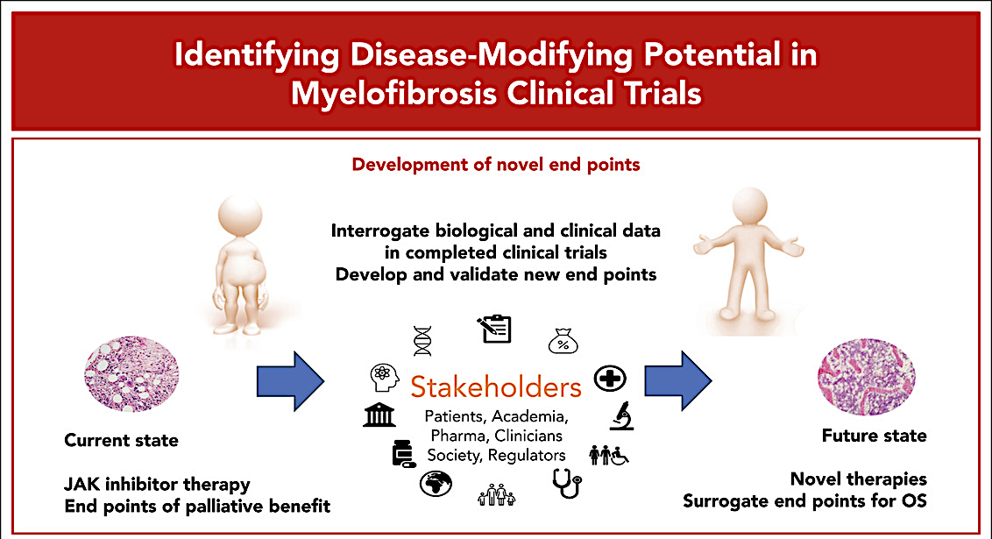
Endpoints
Overall Survival
Progression
Molecular
Biological
Treatment independence
Symptoms
……..Require redefinition

Slide 89
What is your threshold for recommending a change in treatment for patients with MF receiving first-line ruxolitinib or fedratinib?
Lack of response or progression
Lack of any spleen response
Usually a multifactorial decision taking into account cytopenias, spleen, symptoms, any transfusion requirements
If persistent symptoms/splenomegaly at optimal doses, I would consider clinical trials
PLT <50-75K, new transfusion dependence that persists after initial 3 months
of therapy, enlarging spleen, return of symptoms or TKI-specific toxicity
The patient should have true disease progression
and complete loss of benefit
PLT = platelet count; TKI = tyrosine kinase inhibitor

Slide 90
An 80-year-old patient receiving ruxoli­tinib 15 mg BID for intermediate-risk MF for 10 months is found to have increasing asymptomatic splenomegaly, a platelet count of 150,000/μL and Hgb of 13.8 g/dL. Regulatory and reimbursement issues aside, what would you most likely recommend?
Continue ruxolitinib and add luspatercept
Continue ruxolitinib at a higher dose
Switch to momelotinib
Continue ruxolitinib and add luspatercept
Continue ruxolitinib and add luspatercept
Continue ruxolitinib at a higher dose
Hgb = hemoglobin

Slide 91
An 80-year-old patient has been receiving ruxoli­tinib 15 mg BID for intermediate-risk MF for 2 years, and his Hgb has dropped from a baseline of 10.0 g/dL to 7.0 g/dL. Spleen volume and symptoms remain well controlled. Regulatory and reimbursement issues aside, what would you most likely recommend?
Continue ruxolitinib at a higher dose
Continue ruxolitinib and add luspatercept
Switch to fedratinib
Continue ruxolitinib at a higher dose
Continue ruxolitinib at a higher dose
Continue ruxolitinib and add luspatercept

Slide 92
By what increments and over what period of time do you decrease the dose of ruxolitinib for a patient you are tapering off therapy?
5 mg every 3 to 4 days
1 to 2 weeks by 10 mg a week
Usually by 5 mg BID every 2 weeks
Ideally by 5 mg BID increments
Typically by 5 to 10 mg daily for 2 to 3 days each drop
If 10 mg BID or less would stop with no taper,
15 mg BID or higher, drop the dose to 10 mg

Slide 93
Are there any scenarios in which you feel it is appropriate to discontinue therapy with ruxolitinib without tapering and, if so, which ones?
No
Yes, if patient is receiving low-dose ruxolitinib (5 mg BID)
Only when switching to momelotinib
If patient is on 5 mg BID OR has recently started treatment and is experiencing nonhematologic intolerance
At low doses if patient has developed an evolving serious infectious complication but rarely do I stop abruptly if I can avoid it
Yes, if 10 mg BID or lower, would not taper

Slide 94
Based on currently available evidence, do you believe the results from the Phase III SENTRY trial will support the clinical use of or the FDA approval of selinexor in combination with ruxolitinib as first-line treatment for MF?
Clinical use of selinexor/ruxolitinib
FDA approval of selinexor/ruxolitinib
Yes
Yes
Yes
No
Yes
Unsure
No
No
Yes
Yes
No
No

Slide 95
Based on currently available evidence, would you like to have access to selinexor today for any of your patients with MF?
Yes
No
Yes, especially for those with resistant splenomegaly
Yes
Yes
No

Slide 96
If selinexor were to become clinically available, for which patients with MF would you prioritize its use?
Patients who have int-2/high-risk disease and a large spleen
Patients with massive splenomegaly that are planned to go to transplant
Large spleen, possibly HMR disease, higher blasts
Suboptimal response to ruxolitinib as a single agent;
persistent splenomegaly affecting QOL
Very advanced disease with massive splenomegaly, TP53 mutation, other high-risk mutations that predict less response to rux alone
If FDA approved, I will offer it to appropriate patients

Slide 97
How would you characterize the incidence and severity of gastrointestinal side effects among patients with MF receiving selinexor?
Common need for prophylaxis supposed to settle over time; manageable with recommended treatment
High incidence with variable severity
The nausea is real but manageable
Challenging but expected
Occurs in 2/3 and most pronounced in the first several cycles, manageable with prophylaxis and diet modifications
Sounds manageable based on available data

Slide 98
What pre­medication(s), if any, would you generally recommend for a patient who is about to begin treatment with selinexor?
Dual antiemetics
At least one antiemetic and one antidiarrheal
Dual antiemetics
Likely ondansetron with PRN prochlorperazine with
consideration of olanzapine if that was not effective
Ondansetron and dexamethasone
Dual antiemetics

Slide 99
Agenda
Management of Myelofibrosis (MF)
Introduction: The Biopathophysiology of MF
Module 1: Current and Future Clinical Decision-Making in the Absence of Severe Cytopenias — Prof Harrison
Module 2: Managing MF for Patients with Anemia and Thrombocytopenia —
Dr Rampal
Module 3: Upcoming at EHA 2026

Slide 100

Management of Anemic and
Thrombocytopenic Myelofibrosis Patients
Raajit K. Rampal M.D. Ph.D.
Director, MPN and Rare Hematologic Malignancy Program
Director, Center for Hematologic Malignancies

Slide 101
Cytopenic Myelofibrosis
76 yo M presents with fatigue, weight loss, and abdominal fullness
Exam: Splenomegaly (12 cm below costal margin)
CBC: WBC 3.3k (1% blasts), Hb 7.5 g/dL, platelets 44k
Bone marrow biopsy: 90% cellular marrow with myeloid expansion, dysplastic megakaryocytes in clusters, and MF-3 fibrosis with 5% myeloid blasts
Cytogenetics: Normal Karyotype
Myeloid NGS panel: JAK2 V617F+, ASXL1mut+
Diagnosis: Primary Myelofibrosis, Cytopenic subtype
Risk Stratification: DIPSS+ High Risk, MIPSS70+v2.0 Very High Risk
How can we manage cytopenic MF ?

Slide 102
Thrombocytopenia
Incidence and Prevalence
The incidence of thrombocytopenia
(PLT < 100 × 10⁹/L) is approximately 25% in patients newly diagnosed with MF^{[1]}
The prevalence of thrombocytopenia
(PLT < 100 × 10⁹/L) is approximately 68% in all patients diagnosed with MF^{[2]}
1. Masarova L, et al. Eur J Haematol. 2018;100:257-263; 2. Masarova L, et al. Leuk Res. 2020;91:106338.

Slide 103



Anemia In Myelofibrosis
Anemia presents in 35% to 54% of patients at diagnosis¹
~50% of patients with MF require ≥6 RBC transfusions/year
Independent prognostic risk factor for leukemic transformation^{2,3}
Up to 46% of patients become dependent on RBC transfusions within 1 year of diagnosis^{4,5}
Proportion of Patients With Anemia
Percentage of Patients
70
60
50
40
No of Patients
30
20
10
0
Diagnosis ≤1 year >1 year
No of Transfusions/yr
1
2
3
4
5
6
7
JAKi, JAK inhibitor; RBC, red blood cell.
1. Tefferi A, et al. Blood. 2013;122:1395-1398; 2. Rago A, et al. Leuk Res. 2015:3:314-317; 3. Curto-Garcia N, et al. Future Oncol. 2018;14:137-150; 4. Harrison CN, et al. Leukemia. 2016;30:1701-1707; 5. Tefferi A, et al. Mayo Clin Proc. 2012;87:25-33.

Slide 104
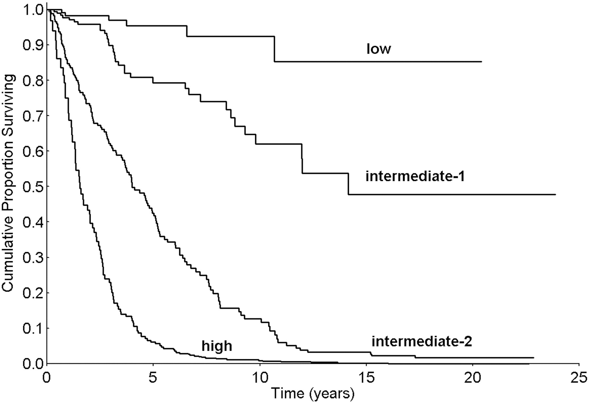
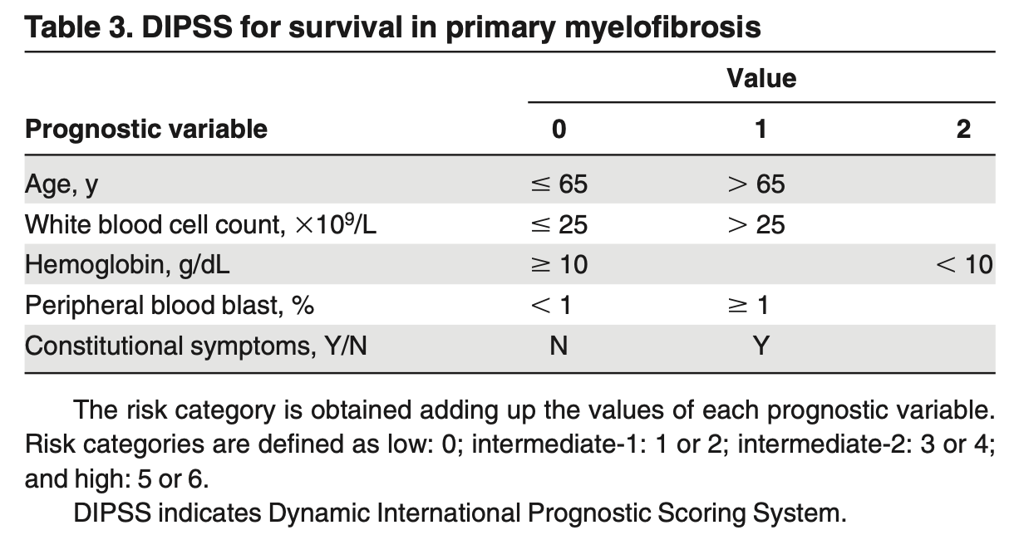
Dynamic International Prognostic Scoring System (DIPSS): Survival by risk group
0 points
1-2 points
5-6 points
3-4 points
Dynamic International Prognostic Scoring System-PLUS (DIPSS-PLUS): Takes into account transfusion requirements, platelet count, and karyotype (Gangat et al. JCO 2011)
Passamonti et al., Blood 2010

Slide 105
RR6: 3 Factors Predict Survival Benefit With
Ruxolitinib in Patients With MF
Assessment of potential predictors of survival in patients with intermediate-1 risk or
higher MF who had been treated with ruxolitinib for ≥6 mo in an observational study
RUX Dose Started
After
3 Mo
After
6 Mo
OS by RR6 Risk Group (Training Cohort)
Risk category Low Intermediate High
RBC Transfusion Need
HR = 2.32
1.00
Low risk
mOS NR
0.75
Spleen Length Reduction ≤30%
0.50
Interm. risk
mOS 61 mo
Overall Survival (%)
0.25
High risk
mOS 33 mo
P <.0001
RUX Dose <20 mg BID
0
0
25
50
75
100
Number at risk
Follow-up (Mo)
  Low
  Intermediate
  High
36
85
67
22
47
21
15
18
7
8
7
2
1
0
0
Response to ruxolitinib after
6 mo of treatment: RR6
Calculator at www.rr6.eu
Risk Category
0
25
50
75
100
The RR6 model was validated in another cohort of patients
(n = 40; P = .0276) treated with ruxolitinib at Moffitt Cancer Center
Maffioli. Blood Adv. 2022;6:1855.

Slide 106
Clinical Needs-Oriented Therapy for MF
Treatment Approaches to Myelofibrosis
Clinical Issue | Treatments
Anemia | ESAs Danazol Corticosteroids | Thalidomide, lenalidomide (IMiDs)
Symptomatic splenomegaly | Ruxolitinib Fedratinib Pacritinib Momelotinib Hydroxyurea | Cladribine, IMiDs Splenectomy HMAs
Constitutional symptoms/QoL | Ruxolitinib Fedratinib Pacritinib Corticosteroids
Thrombocytopenia | Thalidomide, danazol

Slide 107
NCCN Clinical Practice Guidelines in Oncology (NCCN Guidelines®): Management of MF-Associated Anemia¹
Preferred regimens:
Clinical trial
Momelotinib
Other recommended regimens:
Pacritinib
Ruxolitinib combination:
  Luspatercept-aamt
  ESAs (if serum EPO < 500 mU/mL)
  Danazol
Ongoing symptomatic splenomegaly and/or constitutional symptoms
Assess for and
treat alternative causes of anemia (ie, bleeding, nutritional deficiencies, hemolysis)
No splenomegaly or constitutional symptoms
Preferred regimen:
Clinical trial
Other recommended regimens:
ESAs (if serum EPO < 500 mU/mL)
Luspatercept-aamt
Danazol
Pacritinib
Momelotinib
Useful in certain circumstances:
Lenalidomide + prednisone for del(5q)
Preferred regimen:
Clinical trial
Other recommended regimens:
JAK inhibitor combination:
  ESAs (if serum EPO
  < 500 mU/mL)
  Luspatercept-aamt
  Danazol
Useful in certain circumstances:
Switch to pacritinib
Switch to momelotinib
Splenomegaly and constitutional symptoms well-controlled on current JAK inhibitor
del, deletion; EPO, erythropoietin; ESA, erythropoiesis-stimulating agent; JAK, Janus kinase.
Adapted with permission from the NCCN Clinical Practice Guidelines in Oncology (NCCN Guidelines®) for Myeloproliferative Neoplasms. V.2.2025. © 2025

Slide 108
Current JAK Inhibitor Landscape
JAKi | Ruxolitinib | Fedratinib | Pacritinib | Momelotinib
Targets | JAK1, JAK2 | JAK2, JAK1 (less), FLT3, TYK2, many others | JAK2, IRAK1, FLT3, ACVR1 | JAK1, JAK2, ACVR1
Indication | Intermed or high-risk MF with platelets ≥50k | Intermed-2 or high-risk MF with platelets ≥50k | Intermed or high-risk MF with platelets <50k | Approved for MF patients with Anemia
Clinical practice points | Hematologic toxicities | Hematologic toxicities GI toxicities Monitor thiamine | Less cytopenia-inducing GI toxicities Monitor QTc Monitor for bleeding | Less cytopenia-inducing Rare peripheral neuropathy
Verstovsek et al NEJM 2012, Pardananni et al. JAMA Oncology 2015, Mascarenhaas et al. JAMA Oncology 2018, Verstovsek et al Lancet 2023

Slide 109


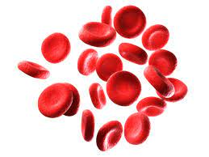


Momelotinib and Pacritinib Inhibit ACVR1
BMP2, BMP6
ACVR1
Hepatocyte
cellular membrane
Serum iron,
hemoglobin,
erythropoiesis
Momelotinib
Pacritinib
Hepcidin
SMAD1,5
P
Chronic inflammation also drives hyperactivation of ACVR1, elevated hepcidin, dysregulated iron metabolism, and anemia of MF^{3,4}
ACVR1, activin A receptor type 1; BMP, bone morphogenetic protein; EPOR, erythropoietin receptor; JAK, Janus kinase; MF, myelofibrosis; MPL, myeloproliferative leukemia protein; SMAD1/5, mothers against decapentaplegic homolog 1/5; STAT, signal transducer and activator of transcription.
1. Chifotides HT, et al. J Hematol Oncol. 2022;15(1):7. 2. Verstovsek S, et al. Future Oncol. 2021;17(12):1449-1458. 3. Asshoff M, et al. Blood. 2017;129(13):1823-1830. 4. Oh ST, et al. Blood Adv. 2020;4(18):4282-4291.

Slide 110
Pacritinib: Phase 3 Trial PERSIST-2
Pacritinib 400 mg QD or 200 mg BID vs BAT (Including JAK1/2 Inhibitors) in MF¹
In this phase 3 trial, 200 mg BID was also tested for potentially improved tolerability, given PK modeling data demonstrating increased daily systemic exposure with lower maximum concentration vs 400 mg QD²
Key Eligibility Criteria
PMF, PET-MF, PPV-MF
Intermediate- or high-risk disease
Moderate-to-severe thrombocytopenia at baseline (≤100x10⁹/L)
No exclusion for Hgb levels or RBC-TD
Prior JAK1/2 inhibitors allowed
1:1:1
Randomization
N=311
Stratification at randomization
Rebound platelet countª
DIPSS risk category
Geographic region
Pacritinib
400 mg QD
Coprimary endpoints
Pooled pacritinib arms vs BAT
SVR ≥35% by MRI/CT
≥50% reduction in TSS^{c}
ITT-efficacy population,^{d} baseline
to week 24
Pacritinib
200 mg BID
BAT^{b}; including JAK1/2 inhibitors
~40% of patients had baseline PLT < 50K
1. Mascarenhas J, et al. JAMA Oncol. 2018;4:652-659. 2. Al-Fayoumi S, et al. Blood. 2013;122;4080.

Slide 111
PERSIST-2: Spleen/Symptom Response
ITT Population
Patients With Platelets <50x10⁹/L
SVR ≥35%¹
≥50% reduction in modified TSS^{2,a}
SVR ≥35%¹
≥50% reduction in modified TSS^{2,a}
Week 24
P=0.004
Week 24
P=0.001
The proportions of patients with much improved or very much improved scores were 57% with pacritinib 200 mg BID versus 28% with BAT
ª Excludes individual symptom score for tiredness from MPN-SAF TSS v2.0; utilized in pivotal trials for other JAK inhibitors.
BAT, best available therapy; BID, twice daily; ITT, intention-to-treat; MPN-SAF, myeloproliferative symptom assessment form; PAC, pacritinib; SVR, spleen volume reduction; TSS, total symptom score.
1. Mascarenhas J, et al. JAMA Oncol. 2018;4:652-659. 2. Data on File. CTI Biopharma Corp. Pacritinib Clinical Overview.

Slide 112
Adverse Events
Adverse Reactions | PAC 200 mg BID (n=106) | BAT (n=98)
Any-grade AEs in >15% of patients in either arm, %
Diarrhea | 48 | 15
Thrombocytopenia | 34 | 24
Nausea | 32 | 11
Anemia | 24 | 15
Peripheral edema | 20 | 15
Vomiting | 19 | 5
Fatigue | 17 | 16
Grade ≥3 AEs in >5% of patients in either arm, %
Thrombocytopenia | 32 | 18
Anemia | 22 | 14
Neutropenia | 7 | 5
Pneumonia | 7 | 3
Serious AEs in >3% of patients in either arm, %
Anemia | 8 | 3
Thrombocytopenia | 6 | 2
Pneumonia | 6 | 4
Congestive heart failure | 4 | 2
Diarrhea with pacritinib most often occurred during weeks 1-8, was manageable, and resolved within 1-2 weeks
Neurological AEs and opportunistic infections rarely reported with pacritinib
Grade ≥3 Events (Pooledª)
Safety outcomes with pacritinib were similar for those with <50x10⁹/L vs 50-100x10⁹/L platelets at baseline
Mascarenhas J, et al. JAMA Oncol. 2018;4:652-659.

Slide 113
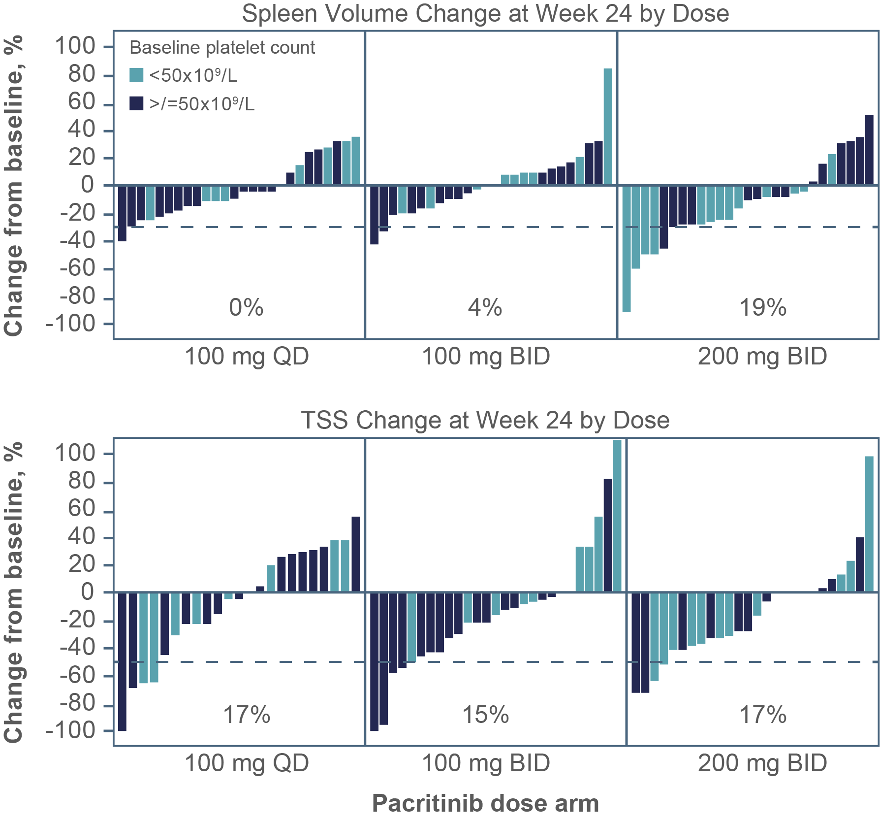

PAC203: Spleen and Symptom Response Across Doses (Evaluable Population, Week 24)
Evaluable SVR in patients with severe thrombocytopenia (<50x10⁹/L) at baseline treated with 200 mg BID
31%
TSS analyzed as a continuous variable:
Deeper reductions with 200 mg BID
BID, twice daily; QD, once daily; SVR, spleen volume reduction.
Gerds AT, et al. Blood Adv. 2020;4:5825-5835.

Slide 114
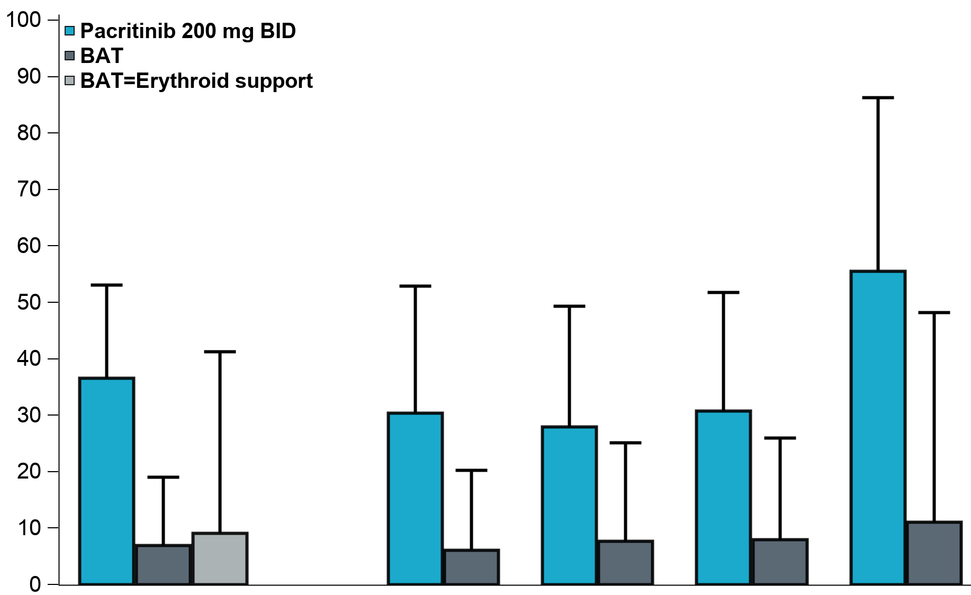
Transfusion Independence (TI): Analysis of PERSIST-2
TI Conversion Rate
Rate of TI (Gale criteria) through Week 24
Pacritinib N=41 | BAT N=43 | P-value
37% | 7% | 0.001
TI conversion better on pacritinib than BAT, including patients receiving erythroid support agents as BAT
  Erythroid support agents were prohibited on the pacritinib arm
P=0.001
Percentage of Patients
95% CI upper bound
Overall
41 PAC,
43 BAT,
11 BAT=ES
Excluding
recent RUX
23 PAC
33 BAT
PLT <50
25 PAC
26 BAT
JAK2
AB <50%
26 PAC
25 BAT
JAK2
AB ≥50%
9 PAC
9 BAT
AB=allele burden; BAT=best available therapy; ES=erythroid support; JAK=Janus associated kinase; PAC=pacritinib; PLT=platelets; recent RUX=no ruxolitinib in prior 30 days; TI=transfusion independence.
Oh ASH 2022

Slide 115
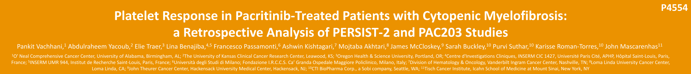
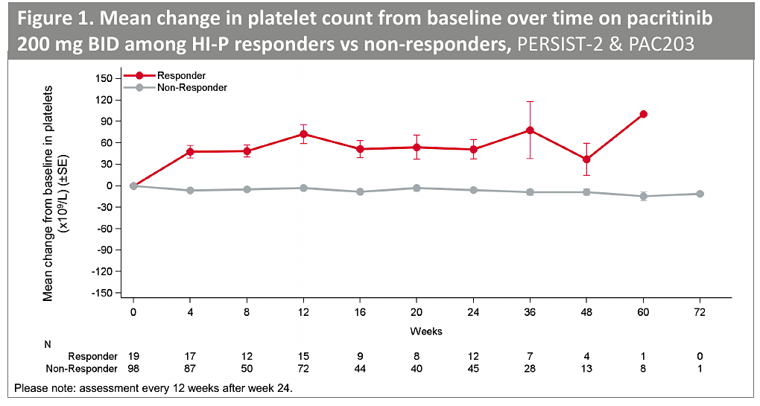
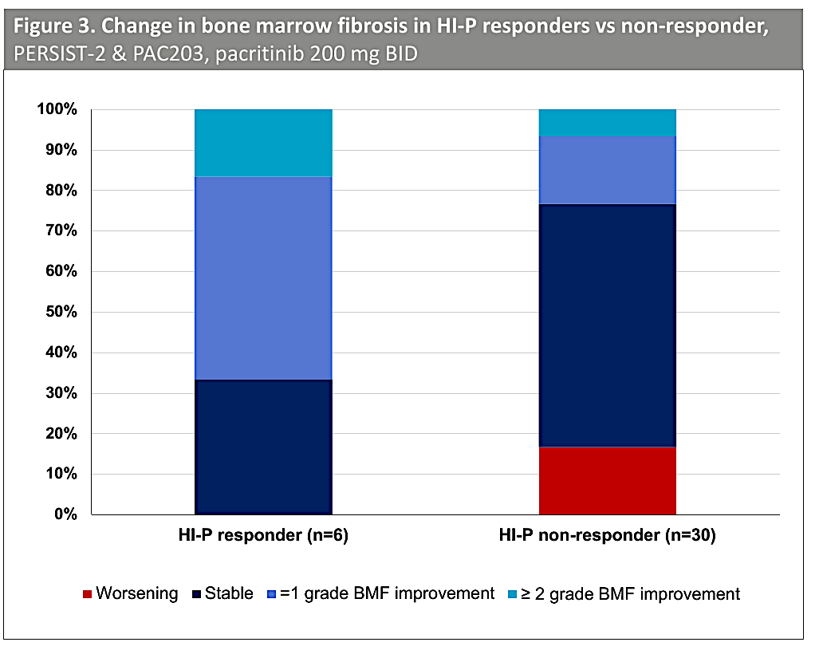
19% of pacritinib treated patients on PAC203 and PERSIST-2 trials experience an improvement in platelet counts
Vachhani P et al. ASH 2023;Abstract 4554

Slide 116
Momelotinib: SIMPLIFY-1 and 2
SIMPLIFY-1: First-Line Population
JAKi naive¹
SIMPLIFY-2: Second-Line Population
Prior ruxolitinib with anemia, thrombocytopenia, or grade ≥3 bleeding²
Primary Endpoint
Primary Endpoint
Day 1
Week 24
Year 7
Day 1
Week 24
Year 7
Double-blind treatment
Open label
LTFU
Randomized treatment
Extension
LTFU
MMB 200 mg QD
MMB 200 mg QD
JAKi-naive
double-blind
N=432
MMB
200 mg daily
RUX-exposed
open label
N=156
MMB
200 mg daily
1:1 randomization
RUX
20 mg BID
2:1 randomization
BAT
88.5%=RUX/RUX+
Goal: | Noninferiority
Momelotinib 200 mg QD: | n=215
Ruxolitinib 20 mg BID: | n=217
Primary Endpoint: | SRR
Secondary Endpoints: | TSS TI rate
Goal: | Superiority
Momelotinib 200 mg QD: | n=104
Best Available Treatment: | n=52
Primary Endpoint: | SRR
Secondary Endpoints: | TSS TI rate
TI defined as absence of RBC transfusions and no Hb <8 g/dL in the prior 12 weeks^{1,2}.
BAT, best available therapy; BID, twice daily; Hb, hemoglobin; JAKi, Janus kinase inhibitor; LTFU, long-term follow-up; MMB, momelotinib; QD, once daily; RBC, red blood cells; RUX, ruxolitinib; SRR, splenic response rate; TI, transfusion independence; TSS, total symptom score.
1. Mesa RA, et al. J Clin Oncol. 2017;35:3844-3850; 2. Harrison CN, et al. Lancet Haematol. 2018;5:e73-e81.

Slide 117
SIMPLIFY-1
Primary Endpoint: SRR
Secondary Endpoint: TSS RR
Momelotinib
n=215
(184 evaluable)
Ruxolitinib
n=217
(204 evaluable)
Momelotinib
n=211
(174 evaluable)
Ruxolitinib
n=211
(190 evaluable)
SRRª=26.5%
SRRª=29.0%
TSS RR=28.4%
TSS RR=42.2%
P=0.011
Momelotinib is noninferior to ruxolitinib
P=0.98
Momelotinib is inferior to ruxolitinib
ª Patients with missing baseline or week 24 spleen volume assessments were considered nonresponders.
SRR, splenic response rate; TSS RR, total symptom score response rate.
Mesa RA, et al. J Clin Oncol. 2017;35:3844-3850.

Slide 118
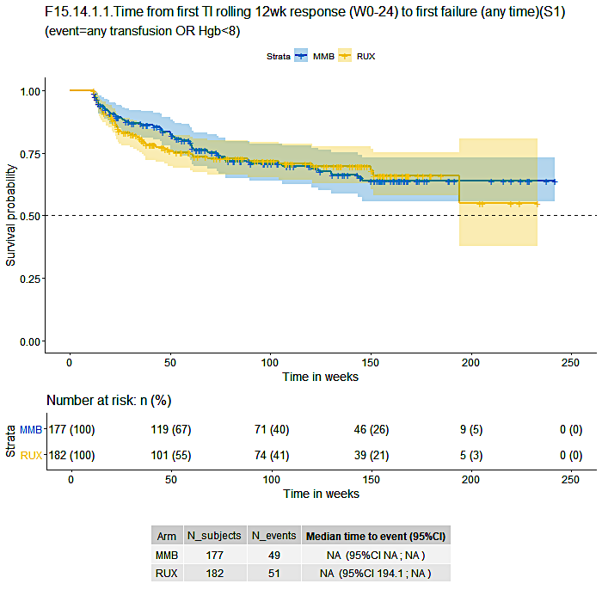
SIMPLIFY-1: TI and Duration of TI
Median duration of TI was not reached²
Follow-up >3 y
Baseline TI rate was maintained with momelotinib¹
Nominal P<0.001
Treatment
Momelotinib
Ruxolitinib→Momelotinib at week 24
Momelotinib Ruxolitinib
Baseline TI rate¹:
Momelotinib 68%
Ruxolitinib 70%
MMB, momelotinib; RUX, ruxolitinib; TI, transfusion independence.
1. Mesa RA, et al. J Clin Oncol. 2017;35:3844-3850; 2. Verstovsek S, et al. ASH 2020. Abstract 54.

Slide 119
MOMENTUM: A Phase 3 Study of Momelotinib Versus DAN in Symptomatic, Anemic, JAKi-Experienced Patients
Double-blind treatment
Open-label crossover
Long-term follow-up
Previously treated
with JAKi
Symptomatic (TSS ≥10)
Anemic (Hgb <10 g/dL)
Platelets ≥25×10⁹/L
Patients
N=195
MMB 200 mg daily
+ PBO
MMB
200 mg daily
Early crossover if confirmed progression
2:1 randomization
DANª 600 mg daily
+ PBO
JAKi taper/washout
≥21 days
Stratification:
TSS
Palpable spleen length
Transfused units in prior 8 weeks
Study site
Planned enrollment: 180
FPE Apr 2020
LPE Jun 2021
Database lock Dec 2021
Primary end point
Day 1
Week 24
MOMENTUM Topline Results at Week 24: All Primary and Key Secondary End Points Met^{1,2}
 | MFSAF TSS^{b} response rate (primary end point) | TI response^{c} rate | SRR^{d} (35% reduction)
MMB (N=130) | 32 (24.6%) | 40 (30.8%) | 30 (23.1%)
DAN (N=65) | 6 (9.2%) | 13 (20.0%) | 2 (3.1%)
 | P=.0095 (superior) | 1-sided P=.0064 (noninferior) | P=.0006 (superior)
Mesa ASCO 2022

Slide 120
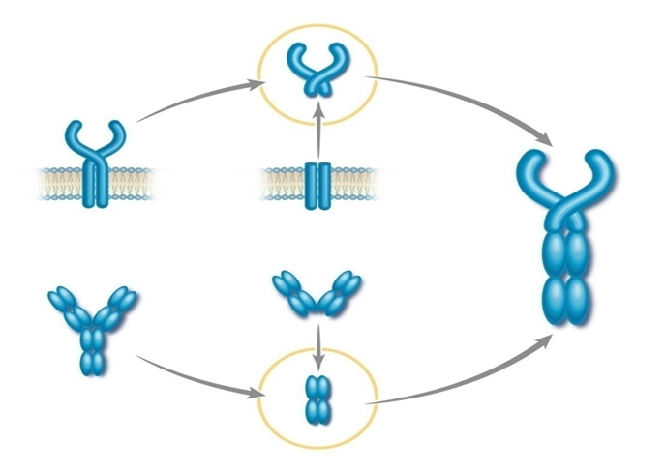
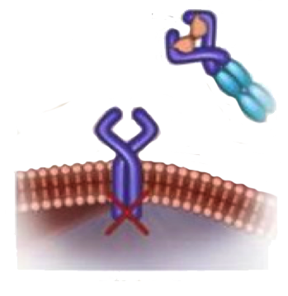
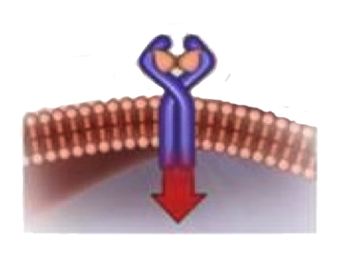
Anemia Therapy in Combination With a JAK Inhibitor
Luspatercept
Fusion protein that acts as activin receptor ligand trap
Sequester ligands of TGFß superfamily, (eg, GDF11) secreted by BM stroma, that inhibit terminal erythropoiesis
Ligand
Ligand
Activin Receptor
RBC Cell Membrane
Smad2
Phosphorylation – Inhibits RBC Maturation
Inhibited
Smad2 Signaling – Promotes RBC Maturation
Iancu-Rubin C et al. Exp Hematol. 2013;41(2):155-166; Carrancio S et al. Br J Haematol. 2014;165:870-882.

Slide 121
Luspatercept in MF and Anemia: Phase 2 study
Not
receiving RUX
Receiving stable dose of RUX
Primary phase of the treatment period
No RBC
transfusions
within last
12 weeks
Subcutaneous luspatercept
1.0 mg/kg with titration up to 1.75 mg/kg every 21 days for 168 days
(N = 79)
Cohort 1
(n = 22)
Cohort 3A
(n = 14)
Day 169
Disease response assessment
Received
RBC transfusions
within last
12 weeks
Cohort 2
(n = 21)
Cohort 3B
(n = 22)
Parameter | RBC Transfusion Dependent
 | No RUX (Cohort 2; n = 21) | RUX (Cohort 3B; n = 19)
RBC transfusion free ≥12 consecutive wk, n (%)* | 2 (10) | 6 (27)
Median duration of response, wk (range) | 49 (16-82) | 42 (12-111)
≥50% reduction in RBC transfusion burden from BL, n (%) | 8 (37) | 10 (46)
Hgb Increase ≥1.5 g/dL From BL for ≥12 Consecutive Wk‡ | No RBC Transfusions
 | No RUX (Cohort 1; n = 22) | RUX (Cohort 3A; n = 14)
Hgb increase ≥1.5 g/dL at every assessment, n (%) | 3 (14) | 3 (21)
Mean Hgb increase ≥1.5 g/dL, n (%) | 4 (18) | 9 (64)
Gerds A, et al. 2020 ASH Annual Meeting. Abstract 2992.

Slide 122
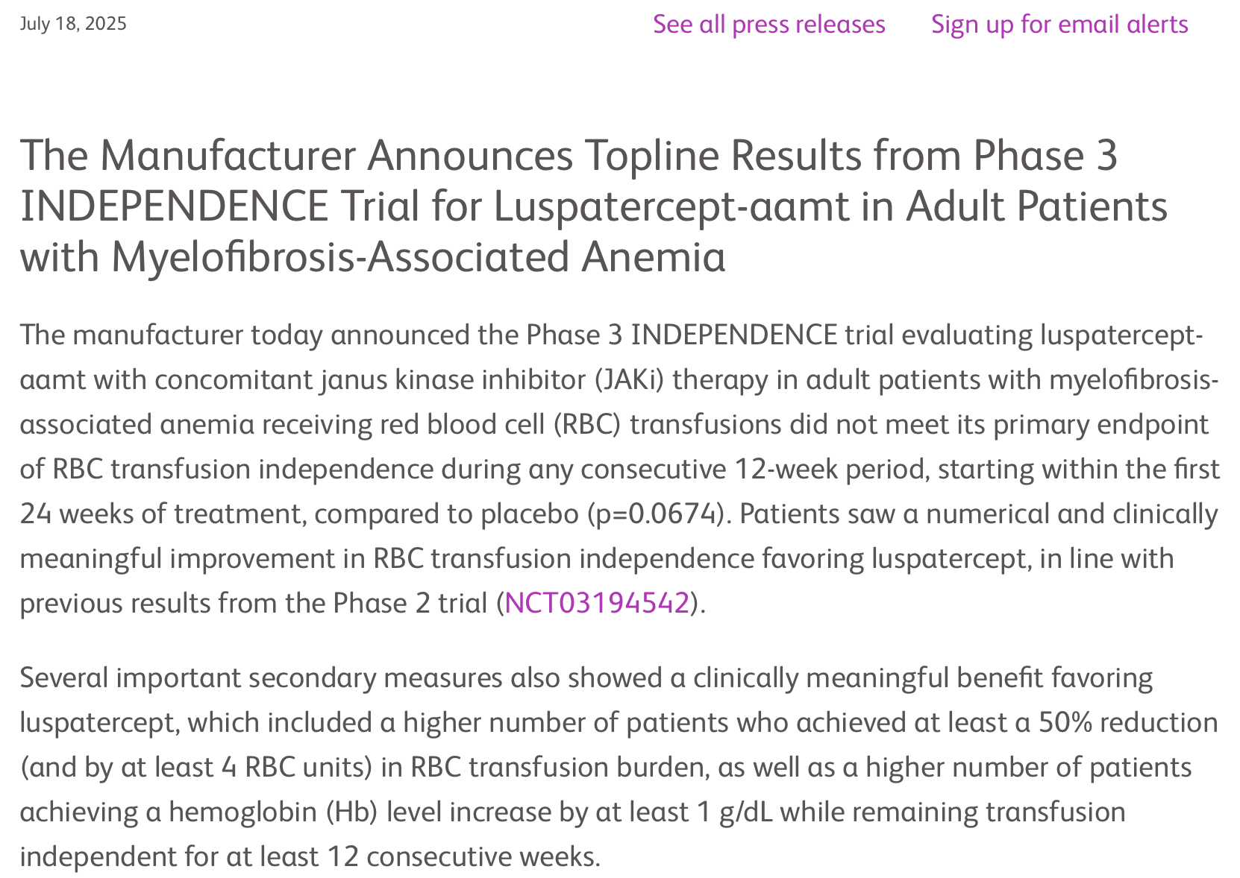
https://news.bms.com/news/details/2025/Bristol-Myers-Squibb-Announces-Topline-Results-from-Phase-3-INDEPENDENCE-Trial-for-Reblozyl-luspatercept-aamt-in-Adult-Patients-with-Myelofibrosis-Associated-Anemia/default.aspx

Slide 123
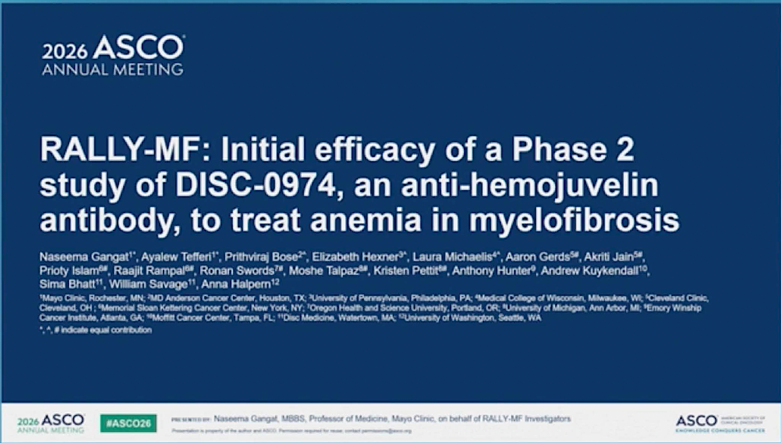
Abstract 6501

Slide 124
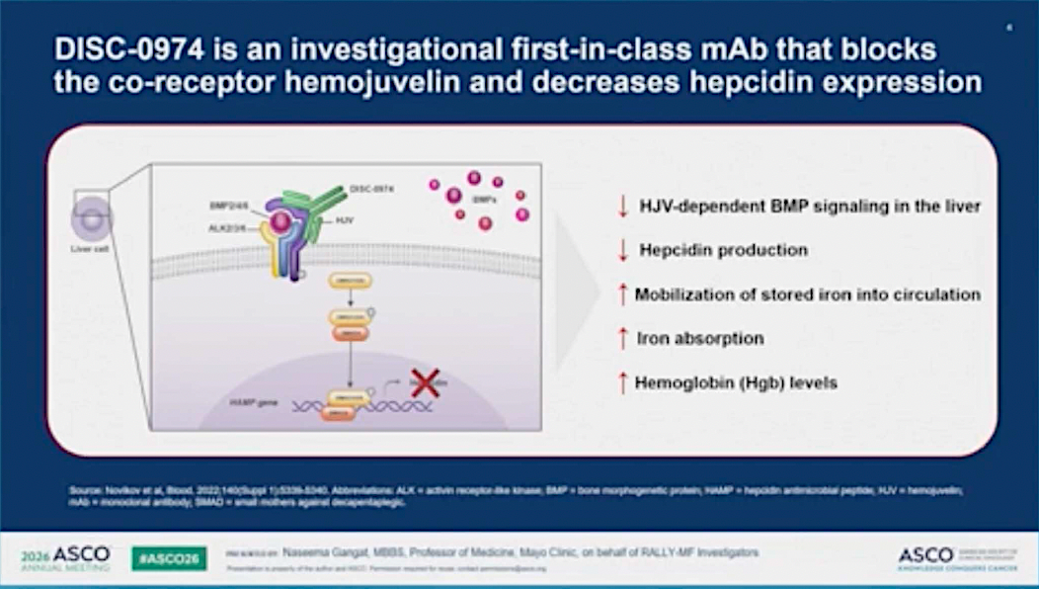

Slide 125
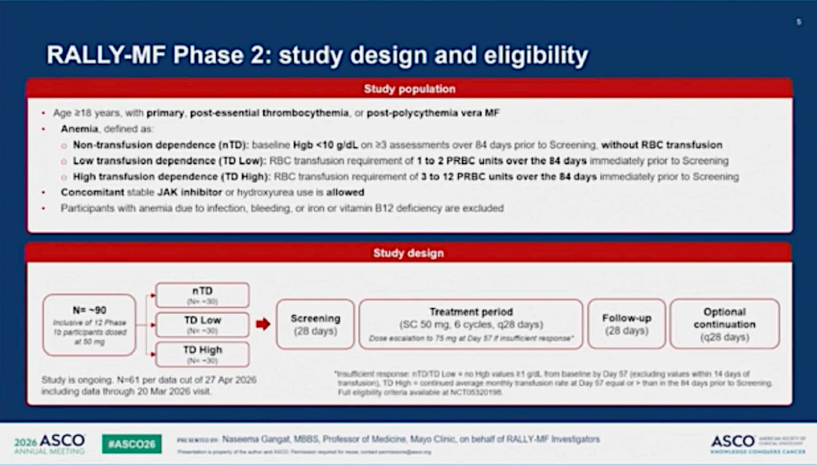

Slide 126
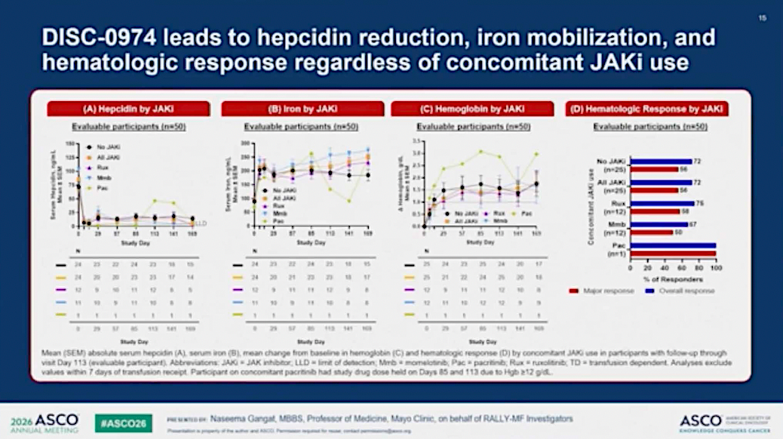

Slide 127
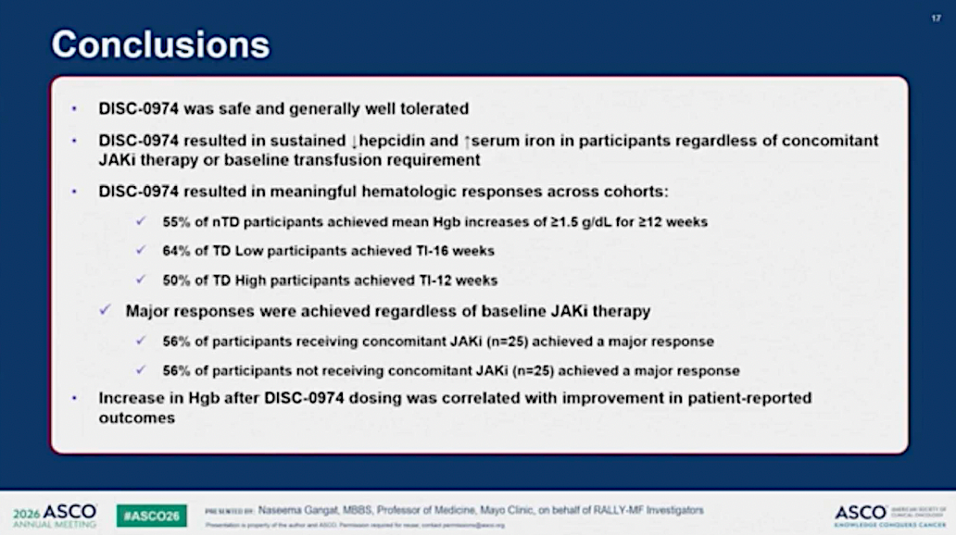

Slide 128
Approximately what proportion of your patients with MF present with severe anemia at initial diagnosis? Approximately what proportion of your patients with MF develop anemia at a later point in the disease course?
Severe anemia at diagnosis
Anemia at later point
in disease course
10%
50%
30%
60%
10%
100%
25%
90%
15%
90%
15%
50%

Slide 129
Approximately what proportion of your patients with MF present with severe thrombocytopenia (platelet count <50,000/μL) at initial diagnosis? Approximately what proportion of your patients with MF develop thrombocytopenia at a later point in the disease course?
Severe thrombocytopenia at diagnosis
Thrombocytopenia at later point
in disease course
5%
40%
10%
40%
10%
67%
10%
60%
10%
70%
10%
30%

Slide 130
What initial treatment would you generally recommend for an otherwise healthy 65-year-old patient with severe anemia (eg, baseline Hgb 7 g/dL) requiring transfusions? If the patient had severe anemia (eg, baseline Hgb 7 g/dL) requiring transfusions and a baseline platelet count of 44,000/μL?
Severe anemia requiring transfusions
Severe anemia requiring transfusions and baseline platelets 44,000/μL
Momelotinib
Momelotinib
Momelotinib
Pacritinib
Momelotinib
Pacritinib
Momelotinib
Momelotinib
Depends on platelet count
Pacritinib
Momelotinib
Momelotinib

Slide 131
A 65-year-old man with symptomatic, high-risk MF and splenomegaly (baseline platelet count 110,000/μL) receives ruxolitinib 15 mg BID to which he has a limited response and 6 months later presents with drenching night sweats, fatigue, abdominal dis­comfort and an increase in spleen size. Platelet count = 110,000/μL, Hgb = 8.2 g/dL. Which treatment would you most likely recommend next?
Momelotinib
Fedratinib
Momelotinib
Fedratinib
Momelotinib
Fedratinib

Slide 132
A 65-year-old man with symptomatic, high-risk MF and splenomegaly (baseline platelet count 110,000/μL) receives ruxolitinib 15 mg BID and experiences significant symptom improvement and a decrease in spleen size. Three years later, he presents with drenching night sweats, fatigue, abdominal dis­comfort and an increase in spleen size. Platelet count = 44,000/μL, Hgb = 11.2 g/dL. Which treatment would you most likely recommend next?
Momelotinib
Pacritinib
Pacritinib
Pacritinib
Pacritinib
Momelotinib

Slide 133
A 65-year-old man with symptomatic, high-risk MF and splenomegaly (baseline platelet count 110,000/μL) receives ruxolitinib 15 mg BID to which he has a limited response and 6 months later presents with drenching night sweats, fatigue, abdominal dis­comfort and an increase in spleen size. Platelet count = 44,000/μL, Hgb of 8.2 g/dL. Which treatment would you most likely recommend next?
Momelotinib
Momelotinib
Pacritinib
Momelotinib
Pacritinib
Momelotinib

Slide 134
A 65-year-old man with symptomatic, high-risk MF and splenomegaly (baseline platelet count 110,000/μL) receives ruxolitinib 15 mg BID and experiences significant symptom improvement and a decrease in spleen size. Three years later, he presents with drenching night sweats, fatigue, abdominal dis­comfort and an increase in spleen size. Platelet count = 44,000/μL, Hgb = 8.2 g/dL. Which treatment would you most likely recommend next?
Momelotinib
Momelotinib
Pacritinib
Momelotinib
Pacritinib
Momelotinib

Slide 135
Agenda
Management of Myelofibrosis (MF)
Introduction: The Biopathophysiology of MF
Module 1: Current and Future Clinical Decision-Making in the Absence of Severe Cytopenias — Prof Harrison
Module 2: Managing MF for Patients with Anemia and Thrombocytopenia —
Dr Rampal
Module 3: Upcoming at EHA 2026

Slide 136
Efficacy and Safety of Luspatercept in Patients with Myelofibrosis on Janus Kinase Inhibitors Who Require Red Blood Cell Transfusions: Primary Analysis of the Phase 3 Independence Trial
Passamonti F et al.
EHA 2026;Abstract S215.
Myeloproliferative Neoplasms – Clinical
SATURDAY JUNE 13, 2026
A2-3 Hall
17:15 – 17:30 CEST.

Slide 137
Results of AJX-101, A Phase 1 Clinical Trial Of The Type II JAK2 Inhibitor AJ1-11095, in Patients with Myelofibrosis Who Have Been Failed by a Type I JAK2 Inhibitor
Mascarenhas J et al.
EHA 2026;Abstract S218.
Myeloproliferative Neoplasms – Clinical
SATURDAY JUNE 13, 2026
A2-3 Hall
18:00 – 18:15 CEST.

Slide 138
Mutant Calreticulin–Specific Monoclonal Antibody, INCA033989, is Well Tolerated and Achieves Robust Spleen, Anemia, and Molecular Responses in Patients (Pts) with Myelofibrosis (MF)
Harrison C et al.
EHA 2026;Abstract S216.
Myeloproliferative Neoplasms – Clinical
SATURDAY JUNE 13, 2026
A2-3 Hall
17:30 – 17:45 CEST.

Slide 139
Transcriptional Subtypes of Myelofibrosis Are Independent of Driver Mutations and Capture Distinct Biology, Outcomes, and Disease Trajectories
Zeng A et al.
EHA 2026;Abstract S214.
Myeloproliferative Neoplasms – Biology & Translational Research
FRIDAY JUNE 12, 2026
A5 Hall
18:00 – 18:15 CEST.

Slide 140
Characterization of Symptoms After Immediate Transition from Ruxolitinib to Momelotinib in Patients with Myelofibrosis: Post Hoc Analyses of the Phase 3 SIMPLIFY-1 and SIMPLIFY-2 Trials
Vachhani P et al.
EHA 2026;Abstract PS2001.
Poster Session: Myeloproliferative Neoplasms – Clinical
SATURDAY JUNE 13, 2026
Hall A
18:45 CEST.

Slide 141
SENTRY-2—A Phase II Study Evaluating Selinexor Monotherapy in Patients with JAKi-Naïve Myelofibrosis and Moderate Thrombocytopenia
Scandura JM et al.
EHA 2026;Abstract PB3546 (Publication Only).

Slide 142
Clinical Outcomes of Momelotinib in a Real-World Cohort of Patients with Myelofibrosis
Ortega Vida E et al.
EHA 2026;Abstract PB3537 (Publication Only).

Slide 143
Real-World Hematologic Outcomes with Momelotinib in Patients with Myelofibrosis and Anemia: A German Retrospective Chart Review
Al-Ali HK et al.
EHA 2026;Abstract PB3455 (Publication Only).

Slide 144
Year in Review: Clinical Investigator Perspectives on the
Most Relevant New Datasets and Advances in Oncology
Novel Treatment Approaches for Non-Hodgkin Lymphoma
A CME/MOC-Accredited Live Webinar
Wednesday, June 17, 2026
5:00 PM – 6:00 PM ET
Faculty
Matthew Matasar, MD
Sonali M Smith, MD
Moderator
Neil Love, MD

Slide 145
Thank you for joining us!
Please take a moment to complete the survey currently up on Zoom. Your feedback is very important to us.
The survey will remain open for
5 minutes after the meeting ends.
Information on how to obtain CME and ABIM MOC credit is provided in the Zoom chat room.
Attendees will also receive an email in 1 to 3 business days with these instructions.

