Slide 1
Consensus or Controversy?
Documenting and Discussing Investigators’ Approaches to the Management of Advanced Gastroesophageal Cancers
Friday, May 29, 2026
11:30 AM – 1:00 PM CT (12:30 PM – 2:00 PM ET)
Faculty
Manish A Shah, MD
Eric Van Cutsem, MD, PhD
Moderator
Yelena Y Janjigian, MD

Slide 2



Faculty
Moderator
Yelena Y Janjigian, MD
Carroll and Milton Petrie Chair
Professor and Chief Attending Gastrointestinal Oncology Service
Memorial Sloan Kettering Cancer Center
New York, New York
Manish A Shah, MD
Professor of Medicine
Bartlett Family Professor of Gastrointestinal Oncology
Chief, Solid Tumor Oncology
Weill Cornell Medicine/NewYork-Presbyterian Hospital
New York, New York
Eric Van Cutsem, MD, PhD
Professor of Medicine
Digestive Oncology
University Hospitals Leuven
Leuven, Belgium

Slide 3



Contributing Clinical Investigators
Zev Wainberg, MD, MSc
Co-Director, GI Oncology Program
Director of Early Phase Clinical Research
Jonsson Comprehensive Cancer Center
UCLA School of Medicine
Los Angeles, California
Sunnie Kim, MD
GI Medical Oncologist
Associate Professor
University of Colorado Cancer Center
Aurora, Colorado
Samuel J Klempner, MD
Program Director, Gastroesophageal Cancers
Tobins Family Endowed Chair in Esophagogastric Cancer
Massachusetts General Hospital
Associate Professor, Harvard Medical School
Boston, Massachusetts

Slide 4
Dr Shah — Disclosures
Faculty
No relevant financial relationships to disclose.

Slide 5
Prof Van Cutsem — Disclosures
Faculty
Consulting Agreements | AbbVie Inc, Agenus Inc, ALX Oncology, Amgen Inc, Arcus Biosciences, Astellas, AstraZeneca Pharmaceuticals LP, Bayer HealthCare Pharmaceuticals, BeOne, BioNTech SE, Boehringer Ingelheim Pharmaceuticals Inc, Bristol Myers Squibb, Cantargia, Daiichi Sankyo Inc, Debiopharm, Eisai Inc, ElmediX, Fosun Pharma, Galapagos NV, GSK, Incyte Corporation, Ipsen Biopharmaceuticals Inc, iTeos Therapeutics, Jazz Pharmaceuticals Inc, Johnson & Johnson, Lilly, Merck KGaA, Microbial Machines, Mirati Therapeutics Inc, MSD, Nordic Pharma, Novartis, Novocure Inc, Pfizer Inc, Pierre Fabre, Sanofi, Seagen Inc, Servier Pharmaceuticals LLC, Simcere, Taiho Oncology Inc, Takeda Pharmaceutical Company Limited, Trishula Therapeutics, Zymeworks Inc

Slide 6
Dr Janjigian — Disclosures
Moderator
Advisory Committees | AstraZeneca Pharmaceuticals LP, Bayer HealthCare Pharmaceuticals, Boehringer Ingelheim Pharmaceuticals Inc, Daiichi Sankyo Inc
Consulting Agreements | AbbVie Inc, AlphaSights, Arcus Biosciences, ARS Pharmaceuticals, AskGene Pharma, Astellas, AstraZeneca Pharmaceuticals LP, Basilea Pharmaceutica Ltd, Bayer HealthCare Pharmaceuticals, BeOne, Boehringer Ingelheim Pharmaceuticals Inc, Bristol Myers Squibb, Cencora, Daiichi Sankyo Inc, Eisai Inc, Geneos Therapeutics, Gilead Sciences Inc, GSK, Guardant Health, HC Wainwright & Co, Health Advances, Imugene, Inspirna, Lilly, Lynx Health, Merck, Merck Serono, Mersana Therapeutics Inc, PeerMD, Pfizer Inc, Sanofi, Seagen Inc, Suzhou Liangyihui Network Technology Co Ltd, Zymeworks Inc
Contracted Research | Arcus Biosciences, Astellas, AstraZeneca Pharmaceuticals LP, Bayer HealthCare Pharmaceuticals, Bristol Myers Squibb, Genentech, a member of the Roche Group, Inspirna, Lilly, Merck, Transcenta
Nonrelevant Financial Relationships | Clinical Care Options, Cycle for Survival, Debbie’s Dream Foundation, eChinaHealth, ED Medresources Inc, Fred’s Team, HMP, i3Health, Imedex, Mashup Media LLC, Master Clinician Alliance, MJH Life Sciences, National Cancer Institute, OncoDaily (stock options), Paradigm Medical Communications, PeerView, Physician Education Resource (PER), Stand Up 2 Cancer, Talem Health, TotalCME, US Department of Defense, WebMD

Slide 7
Dr Kim — Disclosures
Contributing Clinical Investigators
Advisory Committees | AstraZeneca Pharmaceuticals LP, BeOne, Takeda Pharmaceuticals USA Inc
Consulting Agreements | Amgen Inc
Contracted Research | Merck
Data and Safety Monitoring Boards/Committees | Jazz Pharmaceuticals Inc

Slide 8
Dr Klempner — Disclosures
Contributing Clinical Investigators
Advisory Committees | Astellas, AstraZeneca Pharmaceuticals LP, BeOne, Boehringer Ingelheim Pharmaceuticals Inc, Bristol Myers Squibb, Daiichi Sankyo Inc, Eisai Inc, Elevation Oncology, EsoBiotec, Gilead Sciences Inc, I-Mab Biopharma, Jazz Pharmaceuticals Inc, Merck, Mersana Therapeutics Inc, Natera Inc, Novartis, Signet Therapeutics, Taiho Oncology Inc
Consulting Agreements | Astellas
Contracted Research | Arcus Biosciences, AstraZeneca Pharmaceuticals LP, I-Mab Biopharma, Mersana Therapeutics Inc, Parabilis Medicines
Data and Safety Monitoring Boards/Committees | Sanofi
Stock OPTIONS — Private Companies | MBrace Therapeutics
Nonrelevant Financial Relationships | Debbie's Dream Foundation, Degregorio Family Foundation, Gastric Cancer Foundation, National Cancer Institute/National Institutes of Health, NCCN (member of Gastric and Esophageal Guidelines Committees), Stand Up 2 Cancer/AACR, Torrey Coast Foundation

Slide 9
Dr Wainberg — Disclosures
Contributing Clinical Investigators
Consulting Agreements | AbbVie Inc, Amgen Inc, AstraZeneca Pharmaceuticals LP, Boehringer Ingelheim Pharmaceuticals Inc, Bristol Myers Squibb, Daiichi Sankyo Inc, EMD Serono Inc, Gilead Sciences Inc, Incyte Corporation, Ipsen Biopharmaceuticals Inc, Jazz Pharmaceuticals Inc, Lilly, Merck, Novartis, Novocure Inc, Pfizer Inc, Regeneron Pharmaceuticals Inc, Takeda Pharmaceuticals USA Inc
Contracted Research | Arcus Biosciences, Bristol Myers Squibb
Data and Safety Monitoring Boards/Committees | AstraZeneca Pharmaceuticals LP, Pfizer Inc

Slide 10
Research To Practice President Neil Love, MD — Disclosures
Dr Love is president and CEO of Research To Practice. Research To Practice receives funds in the form of educational grants to develop CME activities from the following companies: Aadi Bioscience, AbbVie Inc, ADC Therapeutics, Agendia Inc, Alexion Pharmaceuticals, Amgen Inc, Array BioPharma Inc, a subsidiary of Pfizer Inc, Arvinas, Astellas, AstraZeneca Pharmaceuticals LP, Aveo Pharmaceuticals, Bayer HealthCare Pharmaceuticals, BeOne, Biotheranostics Inc, A Hologic Company, Black Diamond Therapeutics Inc, Blueprint Medicines, Boehringer Ingelheim Pharmaceuticals Inc, Bristol Myers Squibb, Celcuity, Clovis Oncology, Coherus BioSciences, Corcept Therapeutics Inc, CTI BioPharma, a Sobi Company, Daiichi Sankyo Inc, Eisai Inc, Elevation Oncology Inc, Exact Sciences Corporation, Exelixis Inc, Genentech, a member of the Roche Group, Genmab US Inc, Geron Corporation, Gilead Sciences Inc, GSK, Helsinn Therapeutics (US) Inc, ImmunoGen Inc, Incyte Corporation, Ipsen Biopharmaceuticals Inc, Jazz Pharmaceuticals Inc, Johnson & Johnson, Karyopharm Therapeutics, Kite, A Gilead Company, Kura Oncology, Legend Biotech, Lilly, MEI Pharma Inc, Merck, Mersana Therapeutics Inc, Mirati Therapeutics Inc, Mural Oncology Inc, Natera Inc, Novartis, Novartis Pharmaceuticals Corporation on behalf of Advanced Accelerator Applications, Novocure Inc, Nuvalent, Nuvation Bio Inc, Pfizer Inc, Pharmacyclics LLC, an AbbVie Company, Puma Biotechnology Inc, Regeneron Pharmaceuticals Inc, Revolution Medicines Inc, Rigel Pharmaceuticals Inc, R-Pharm US, Sanofi, Seagen Inc, Servier Pharmaceuticals LLC, SpringWorks Therapeutics Inc, Stemline Therapeutics Inc, Sumitomo Pharma America, Summit Therapeutics, Syndax Pharmaceuticals, Taiho Oncology Inc, Takeda Pharmaceuticals USA Inc, TerSera Therapeutics LLC, and Tesaro, A GSK Company.

Slide 11
Commercial Support
This activity is supported by educational grants from Astellas and Jazz Pharmaceuticals Inc.
Research To Practice CME Planning Committee Members,
Staff and Reviewers
Planners, scientific staff and independent reviewers for Research To Practice have no relevant financial relationships to disclose.

Slide 12
This educational activity contains discussion of
non-FDA-approved uses of agents and regimens. Please refer to official prescribing information for each product for approved indications.

Slide 13



Clinicians in the Meeting Room
Networked iPads are available.
Review Program Slides: Tap the Program Slides button to review speaker presentations and other program content.
Answer Survey Questions: Complete the pre- and postmeeting surveys. Survey questions will be discussed throughout the meeting.
Ask a Question: Tap Ask a Question to submit a challenging case or question for discussion. We will aim to address as many questions as possible during the program.
For assistance, please raise your hand. Devices will be collected at the conclusion of the activity.
Notes:
13

Slide 14

Clinicians Attending via Zoom
Review Program Slides: A link to the program slides will be posted in the chat room at the start of the program.
Answer Survey Questions: Complete the pre- and postmeeting surveys.
Ask a Question: Submit a challenging case or question for discussion using the Zoom chat room.
Get CME Credit: A credit link will be provided in the chat room at the conclusion of the program.
Notes:
14

Slide 15

About the Enduring Program
The live meeting is being video
and audio recorded.
The proceedings from today will
be edited and developed into
an enduring web-based program.
An email will be sent to all attendees
when the activity is available.
To learn more about our education programs, visit our website, www.ResearchToPractice.com
Notes:
15
15

Slide 16
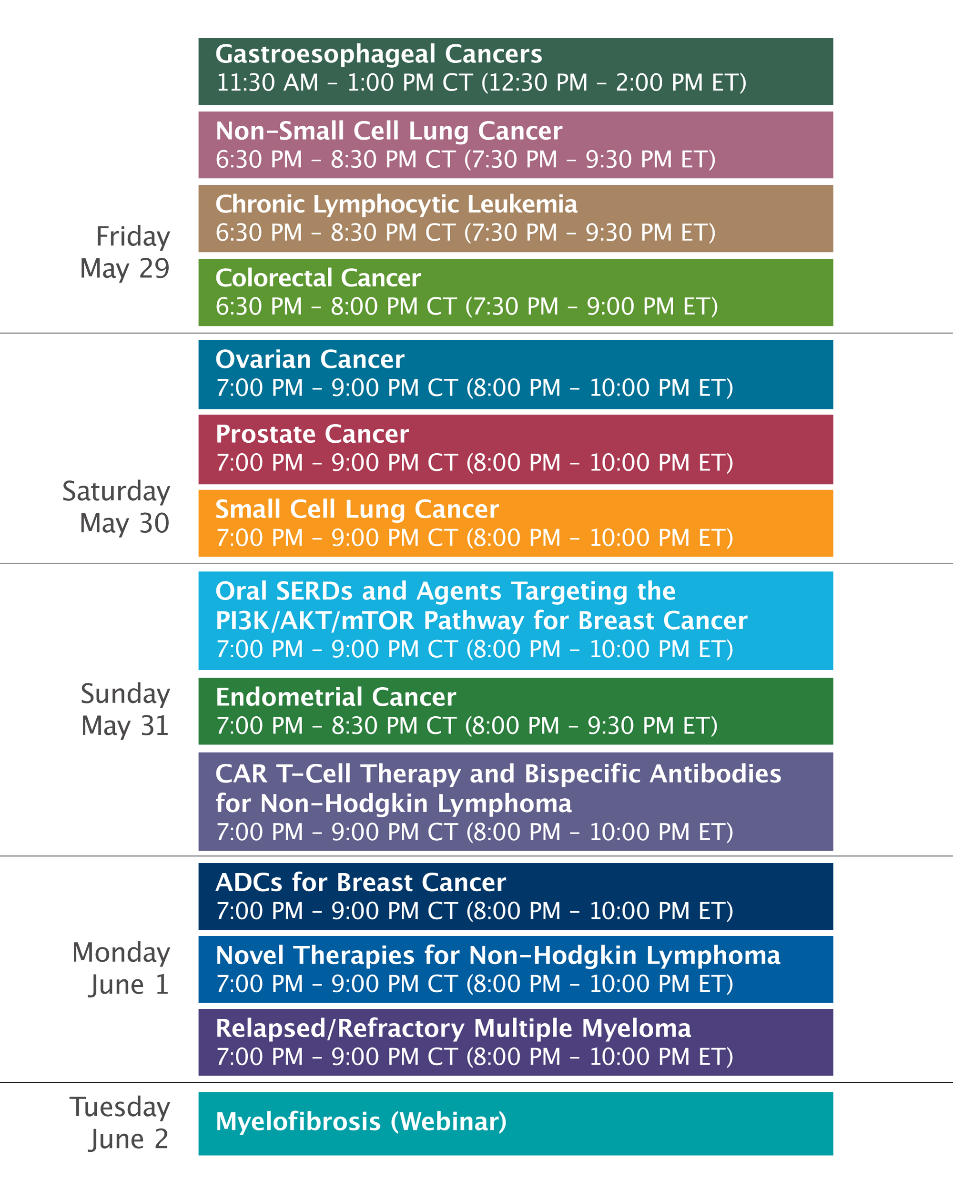

Slide 17
Consensus or Controversy?
Documenting and Discussing Investigators’ Approaches to the Management of Advanced Gastroesophageal Cancers
Friday, May 29, 2026
11:30 AM – 1:00 PM CT (12:30 PM – 2:00 PM ET)
Faculty
Manish A Shah, MD
Eric Van Cutsem, MD, PhD
Moderator
Yelena Y Janjigian, MD

Slide 18
Agenda
Module 1: HER2-Targeted Approaches in Advanced Gastroesophageal Cancers —Prof Van Cutsem
Module 2: Targeting CLDN18.2 in Advanced Gastroesophageal Cancers — Dr Shah
Module 3: Available Immunotherapeutic Strategies for Advanced Gastroesophageal Cancers — Dr Janjigian

Slide 19
Agenda
Module 1: HER2-Targeted Approaches in Advanced Gastroesophageal Cancers —Prof Van Cutsem
Module 2: Targeting CLDN18.2 in Advanced Gastroesophageal Cancers — Dr Shah
Module 3: Available Immunotherapeutic Strategies for Advanced Gastroesophageal Cancers — Dr Janjigian

Slide 20


HER2-Targeted Approaches
in Advanced
Gastroesophageal Cancers
Prof Eric Van Cutsem, MD, PhD
Digestive Oncology
Leuven, Belgium
Eric.VanCutsem@kuleuven.be

Slide 21
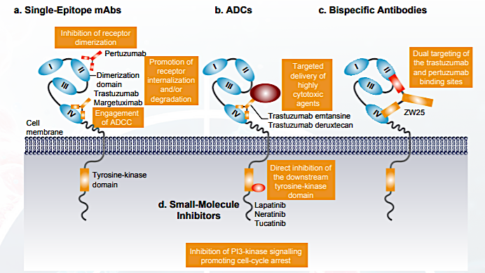
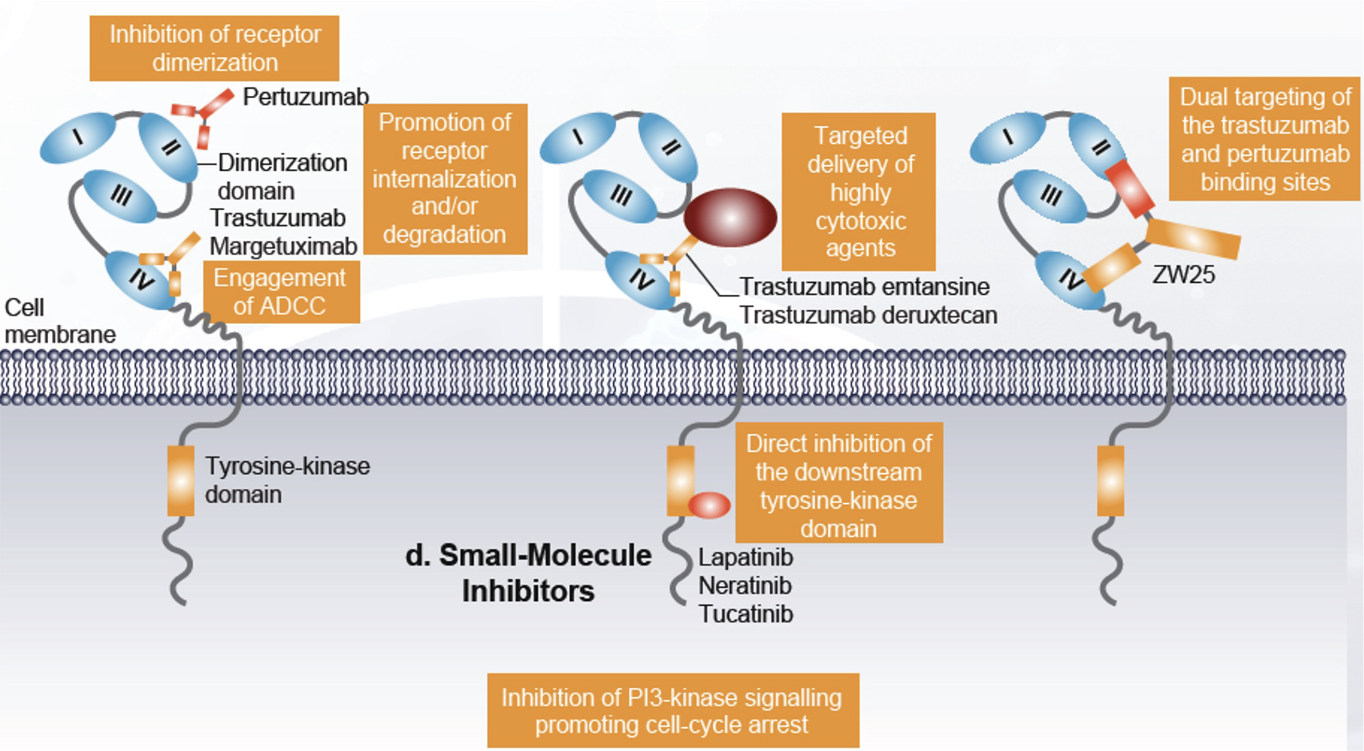
Mechanism of Action of HER2-Targeting Therapies
Oh DY, Bang YJ. Nat Rev Clin Oncol. 2020;17:33-48.

Slide 22
KEYNOTE-811 Global Cohort: Randomized, Double-Blind, Phase 3 Study of dual PD-1 & HER2 blockade
Pembrolizumab 200 mg IV Q3W
+
Trastuzumab and FP or CAPOXª
for up to 35 cycles
Key Eligibility Criteria
Unresectable or metastatic gastric or GEJ adenocarcinoma
No prior systemic therapy in advanced setting
HER2-positive tumor by central review (IHC 3+ or IHC 2+ ISH+)
ECOG PS 0 or 1
R 1:1
N ≈ 692
Placebo IV Q3W
+
Trastuzumab and FP or CAPOXª
for up to 35 cycles
Stratification Factors
Geographic region (Australia/Europe/ Israel/North America vs Asia vs ROW)
PD-L1 CPS (≥1 vs <1)
Chemotherapy choice (FP vs CAPOX)
End Points
Dual primary: OS and PFS per RECIST v1.1 by BICR
Key secondary: ORR and DOR per RECIST v1.1 by BICR and safety
ªTrastuzumab: 6 mg/kg IV Q3W following an 8 mg/kg loading dose. FP: 5-fluorouracil 800 mg/m² IV on D1-5 Q3W + cisplatin 80 mg/m² IV Q3W. CAPOX: capecitabine 1000 mg/m² BID on
D1-14 Q3W + oxaliplatin 130 mg/m² IV Q3W.
BICR, blinded independent central review; CPS, combined positive score (number of PD-L1–staining cells [tumor cells, lymphocytes, macrophages] divided by the total number of viable
tumor cells, multiplied by 100). KEYNOTE-811 ClinicalTrials.gov identifier, NCT03615326.
Yanjigan Y, …. Van CutsemE et al, ESMO GI/WCIGC Ann Onc 2021,LBA4 & Nature Medicine dec 2021

Slide 23
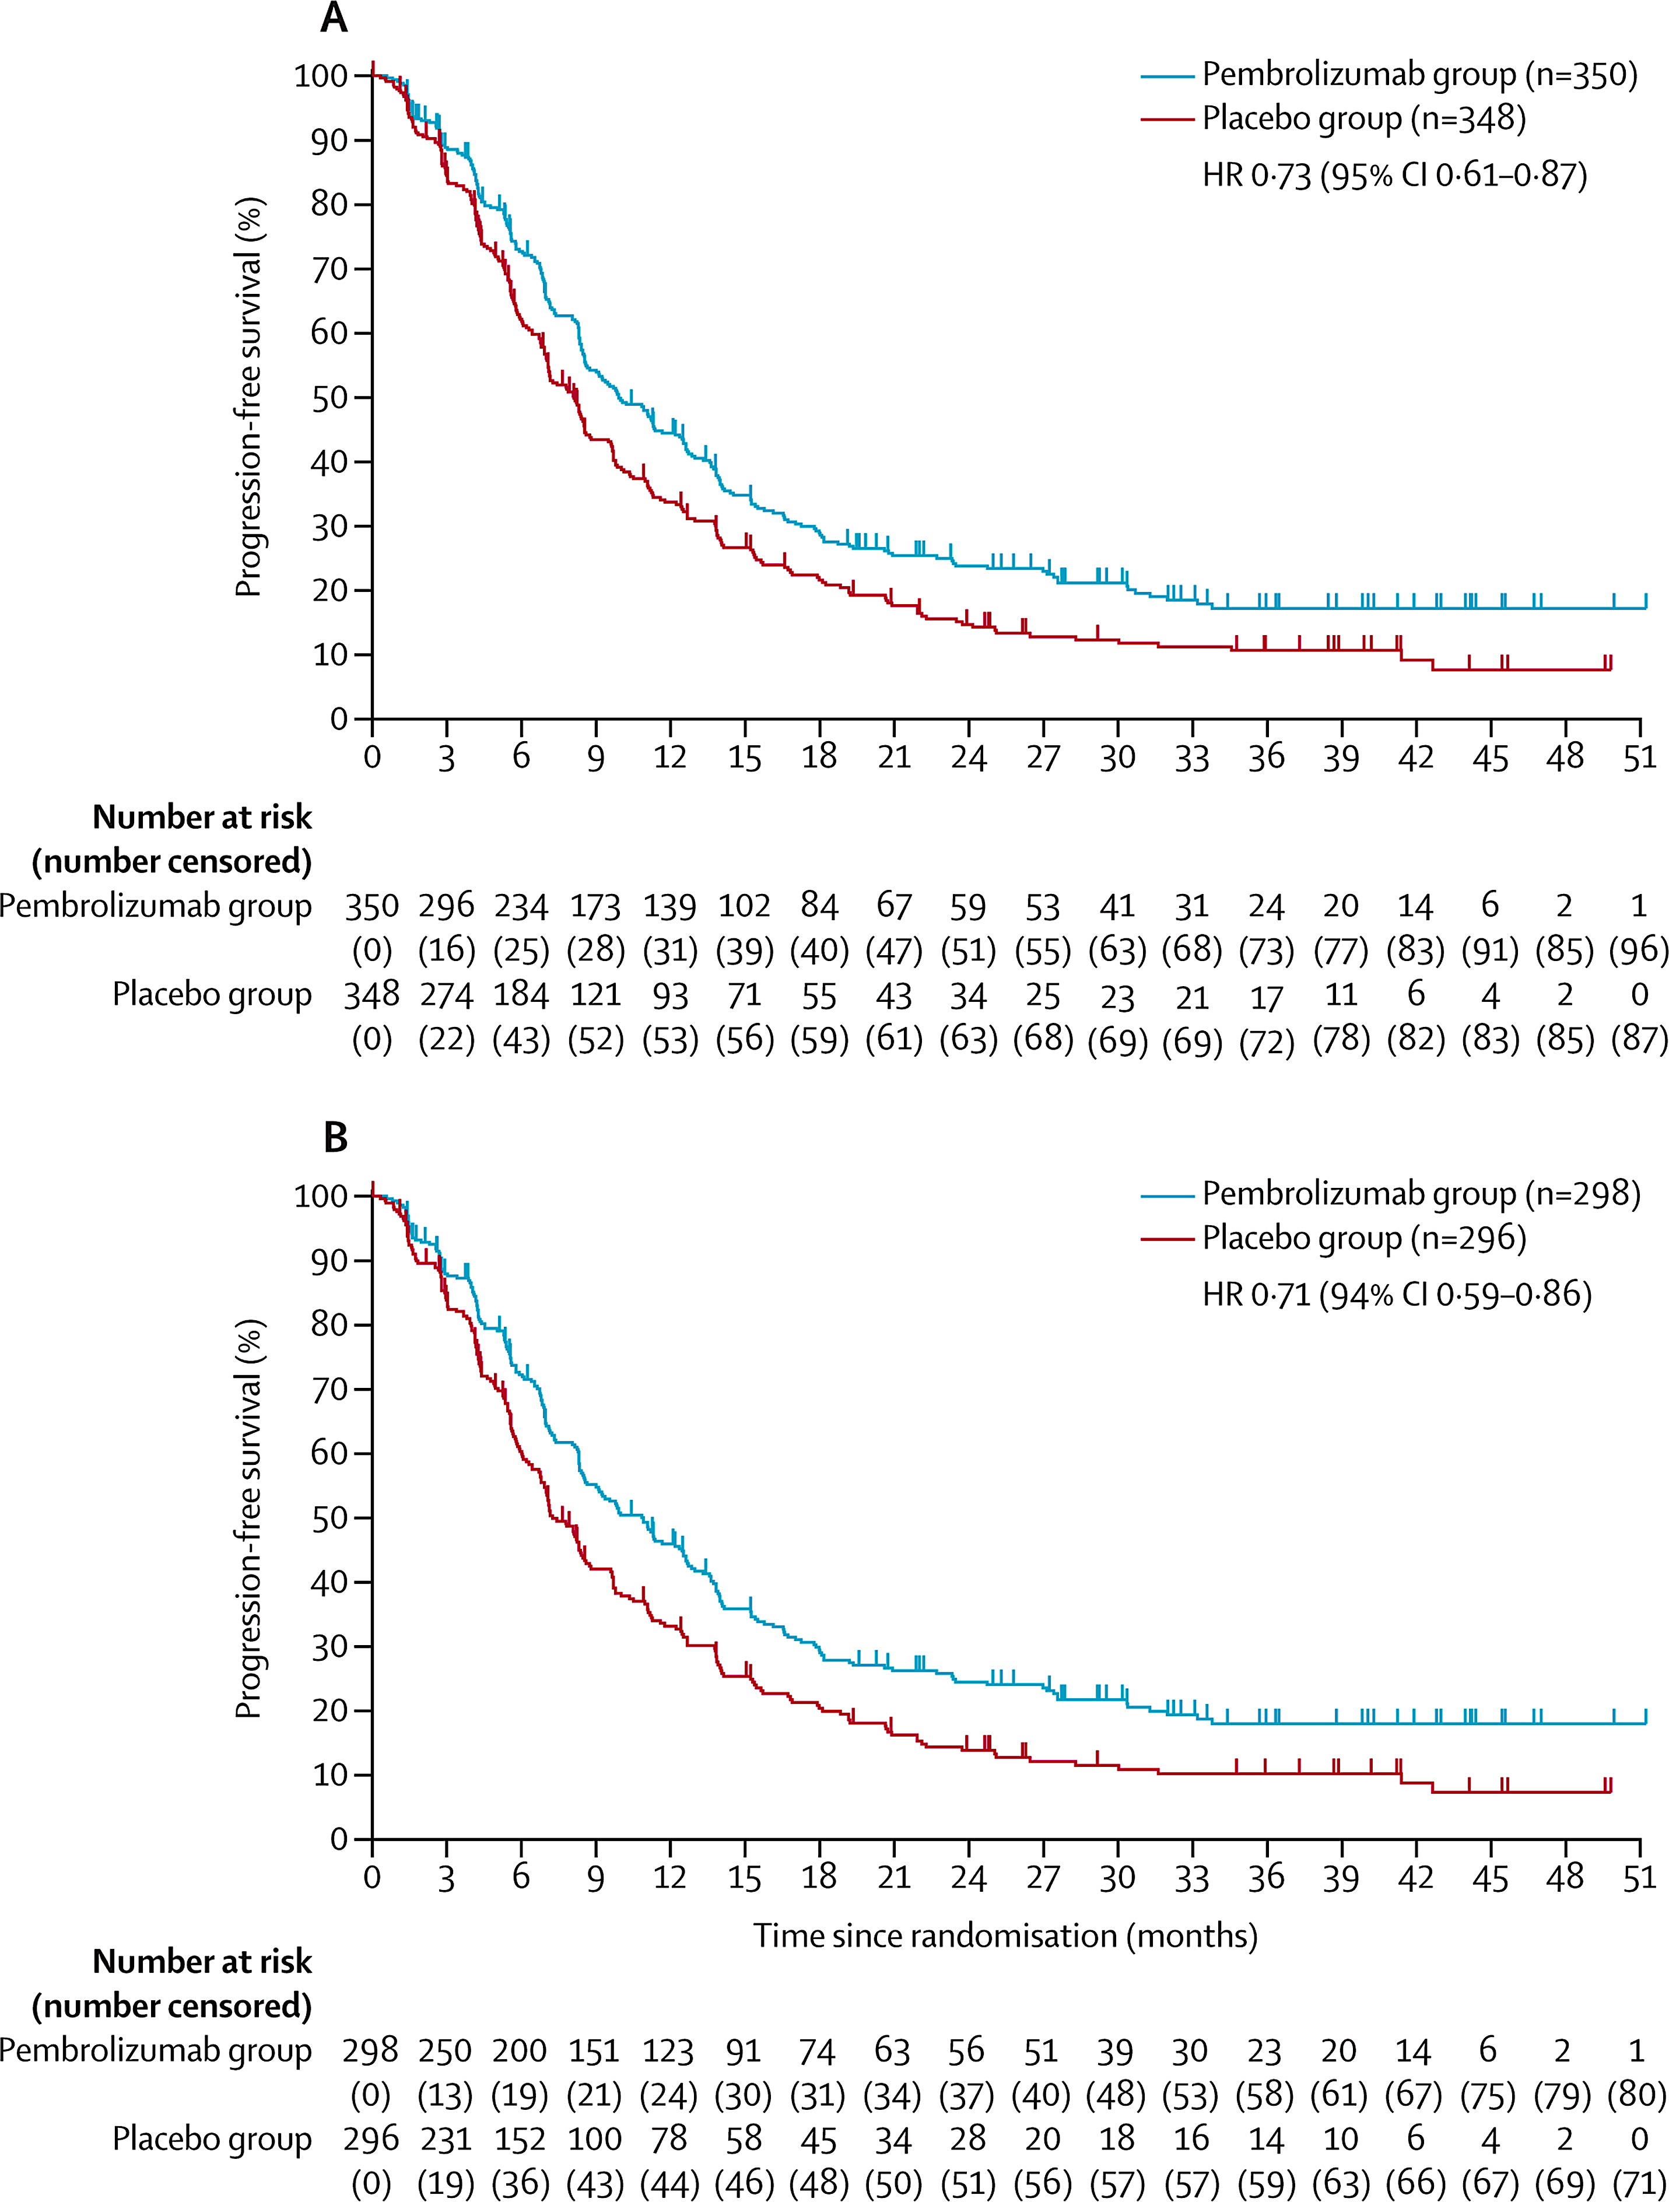
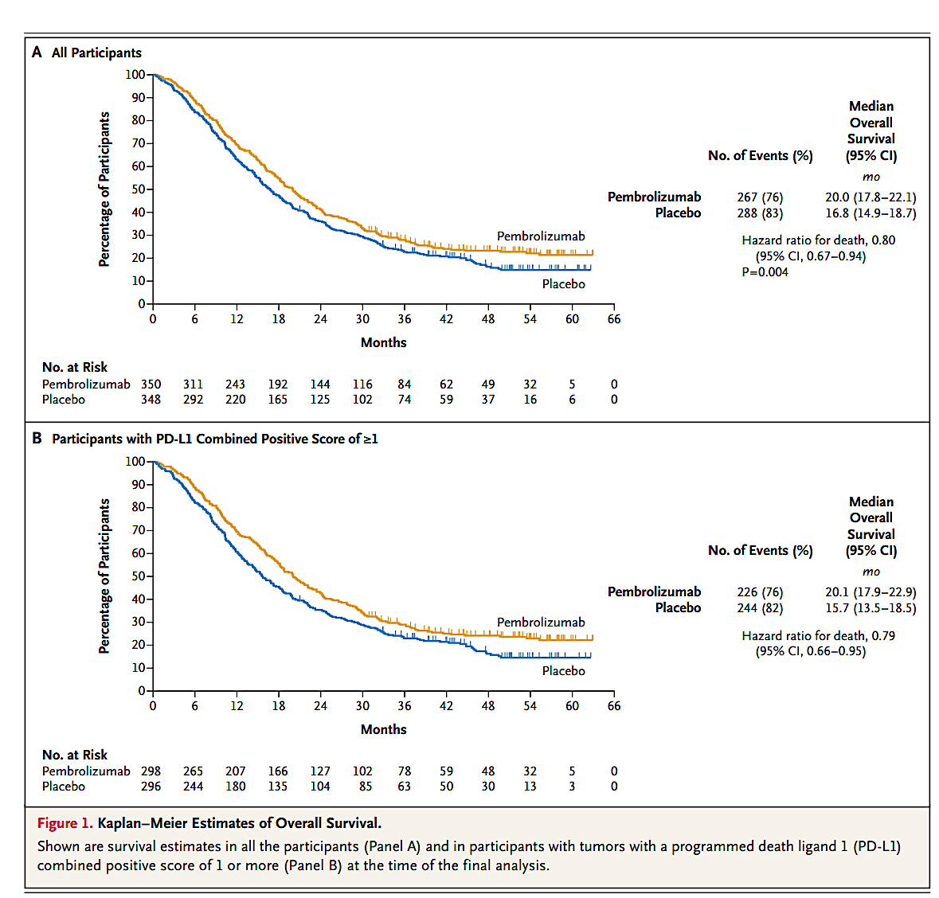
KEYNOTE-811 Global Cohort: Randomized, Double-Blind, Phase 3 Study of dual PD-1 & HER2 blockade
Figure 2
Progression-free survival in the intention-to-treat population at the third interim analysis
Kaplan-Meier estimates of progression-free survival in all patients (A) and in the subgroup of patients with tumours with a PD-L1 combined positive score of 1 or more (B). The HR for progression or death is provided on each graph. Tick marks on the Kaplan-Meier curves represent data censored at the time of last imaging assessment. HR=hazard ratio.
Janjigian Y…. Van Cutsem E et al, Lancet 2023
Janjigian Y…Van Cutsem E et al, New Engl J Med 2024
The Lancet DOI: (10.1016/S0140-6736(23)02033-0)

Slide 24
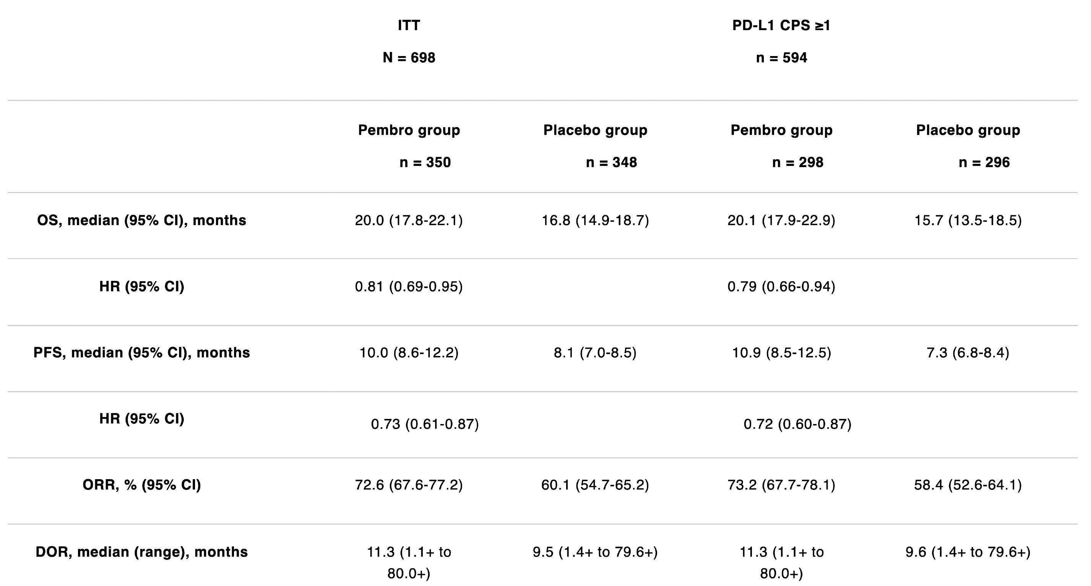
KEYNOTE-811: 6-year median follow-up
Kawazoe A… Van Cutsem E et al, ASCO 2026: A4040

Slide 25
HER-2 directed bispecific antibody: Zanidatamab
ECD2
ECD4
Fab
scFv
Zanidatamab is a humanized dual HER2-targeted bispecific IgG1-like antibody that binds to the HER2 juxtamembrane domain (ECD4) and dimerization domain (ECD2)
This biparatopic binding enables zanidatamab to crosslink neighboring HER2 proteins, leading to receptor clustering
The clustering induces potent complement-dependent cytotoxicity (CDC) and antibody-dependent cellular cytotoxicity (ADCC)
Fc region
HER2
HER2
II
II
IV
IV
Zanidatamab: FDA& EMA-approved for HER2+ BTC (IHC=3+, previously treated)
Weisser N, et al. Nat Commun. 2023.

Slide 26
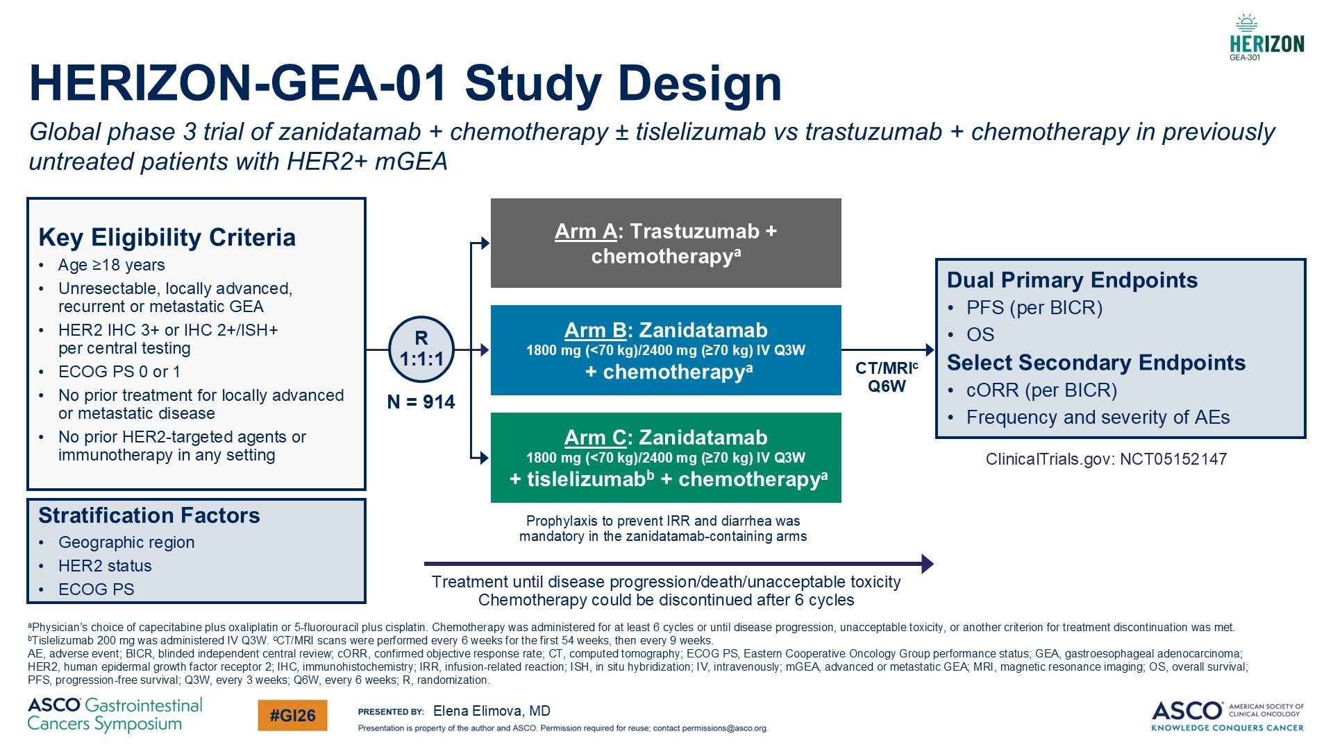

Slide 27
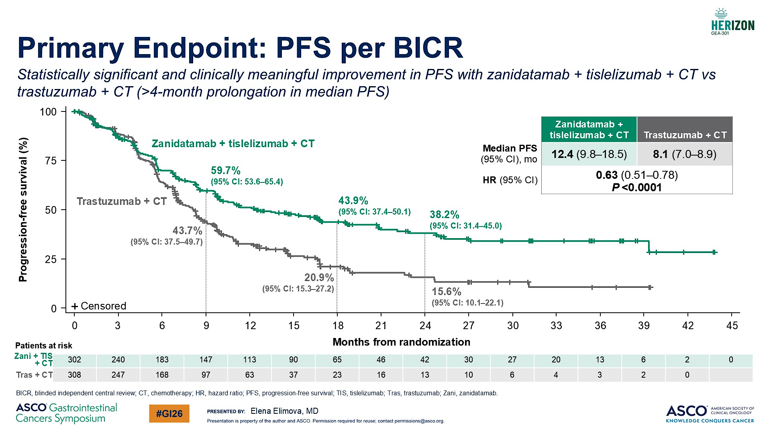

Slide 28
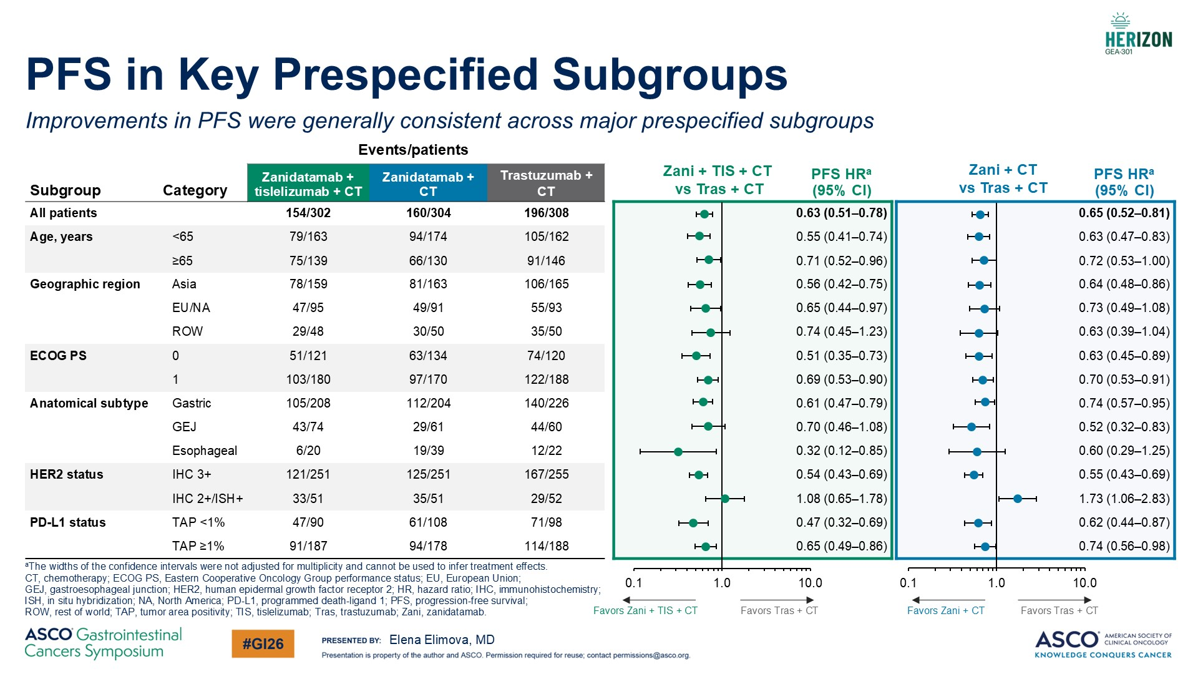

Slide 29
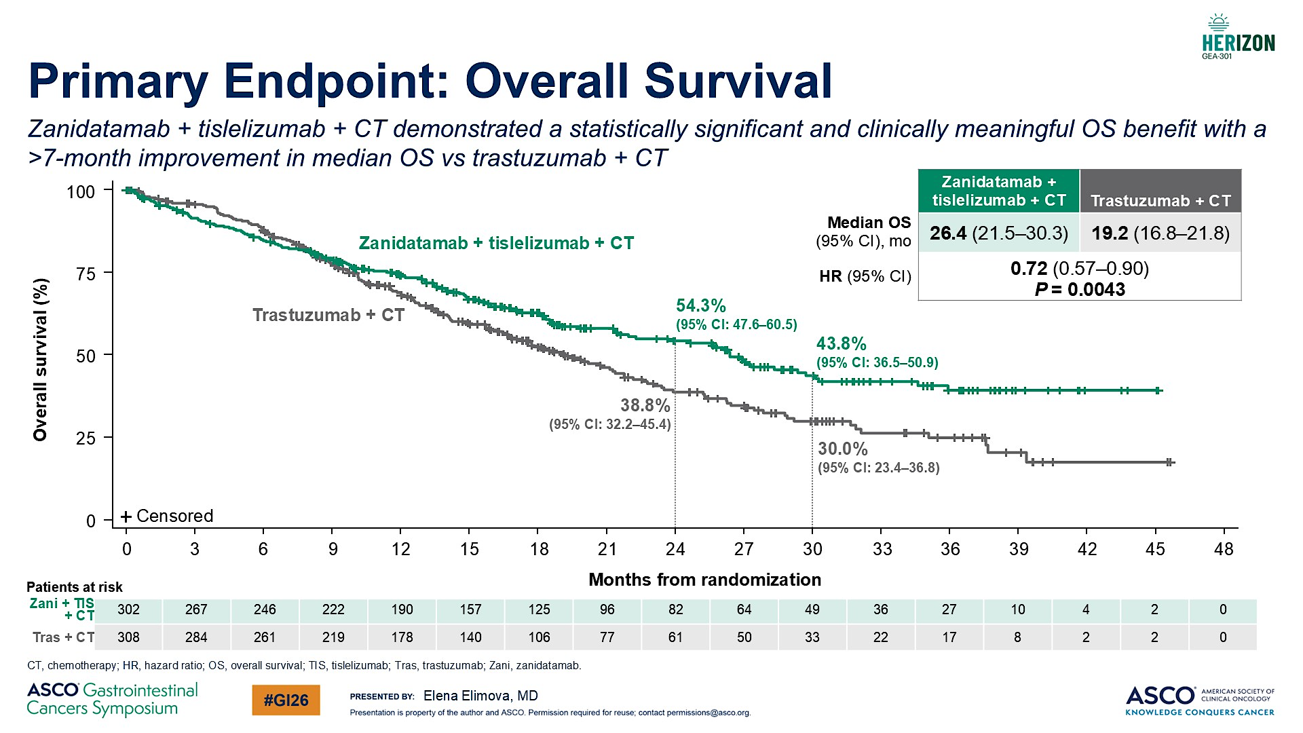

Slide 30
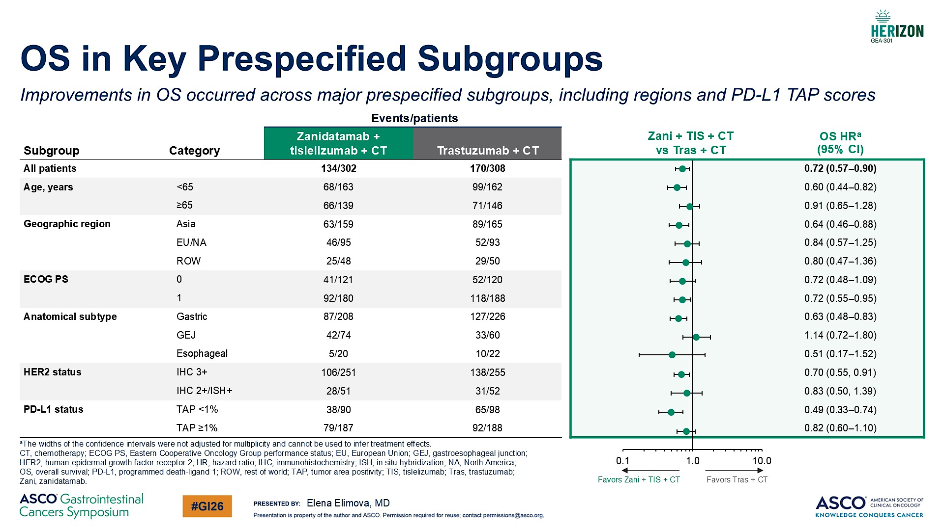

Slide 31
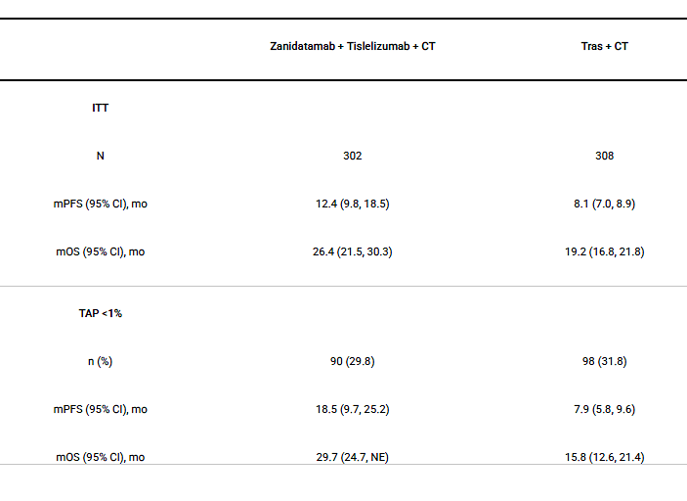
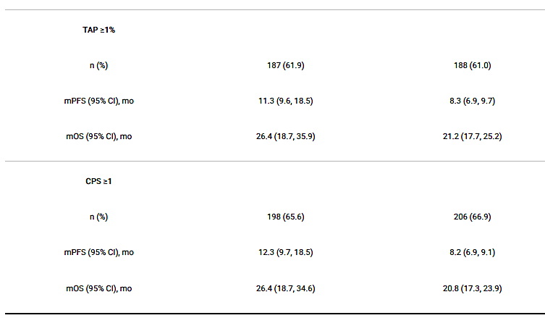
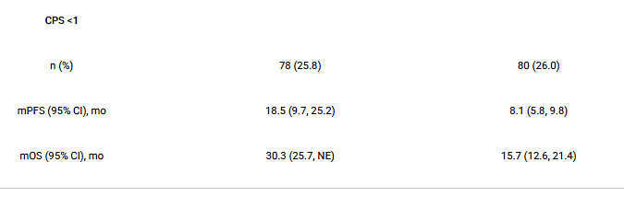
PD-L1 subgroup analysis from HERIZON-GEA-01.
With 26 mo median follow-up, PFS (HR, 0.63; P <0.001) and OS (HR, 0.72; P = 0.004) were significantly prolonged with zanidatamab + tislelizumab + CT vs tras + CT in the ITT population.
In pts treated with zanidatamab + tislelizumab + CT, similarly prolonged PFS and OS were observed in PD-L1–negative and PD-L1–positive pts
Rha S et al, ASCO 2026, A4010

Slide 32
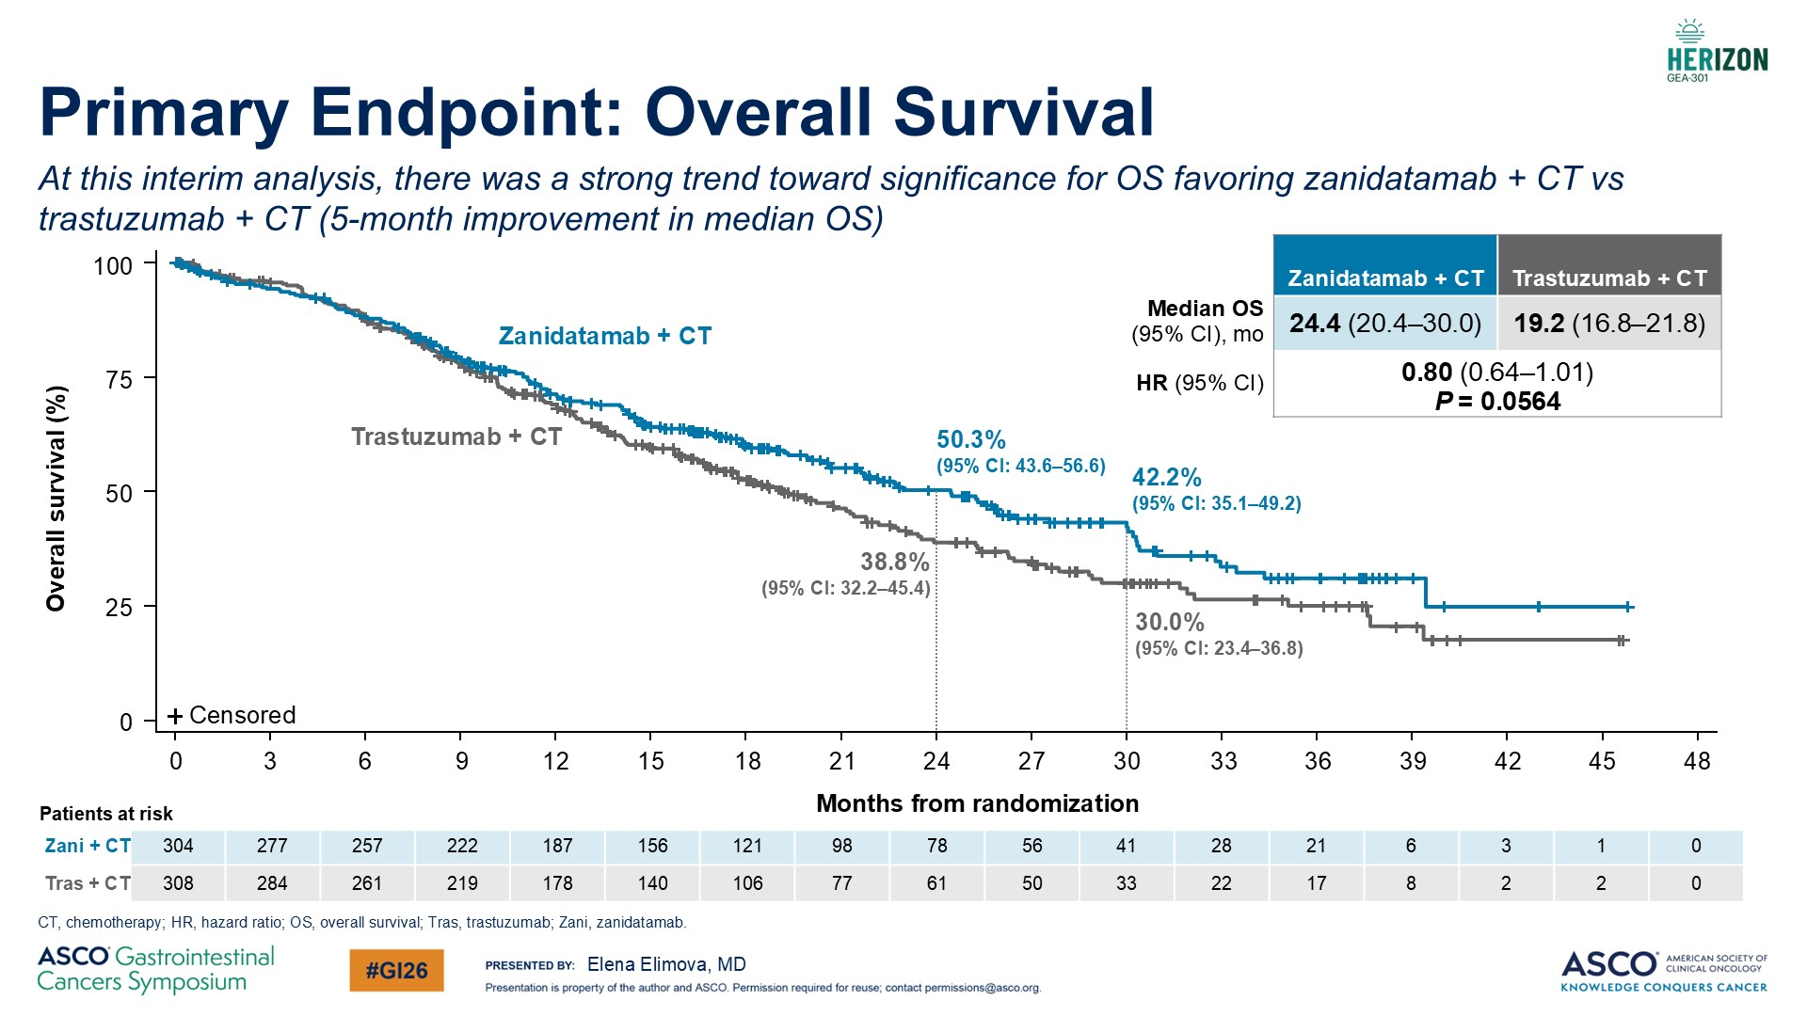

Slide 33
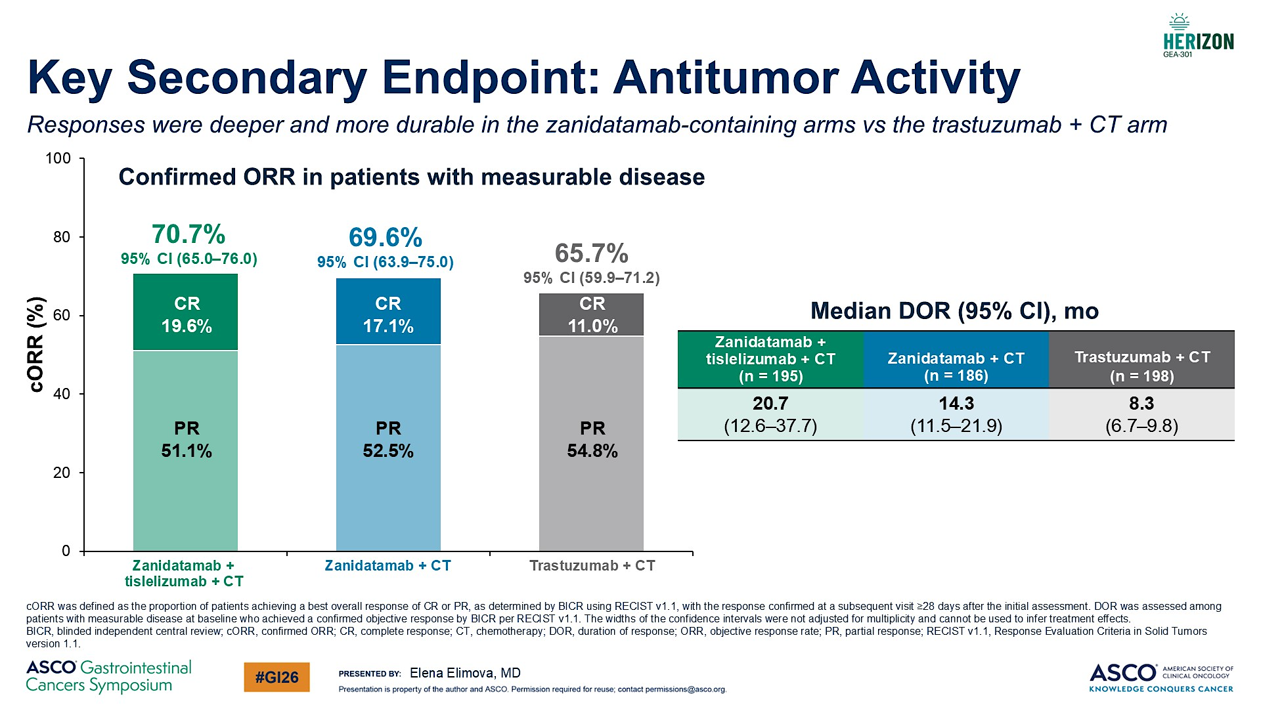

Slide 34
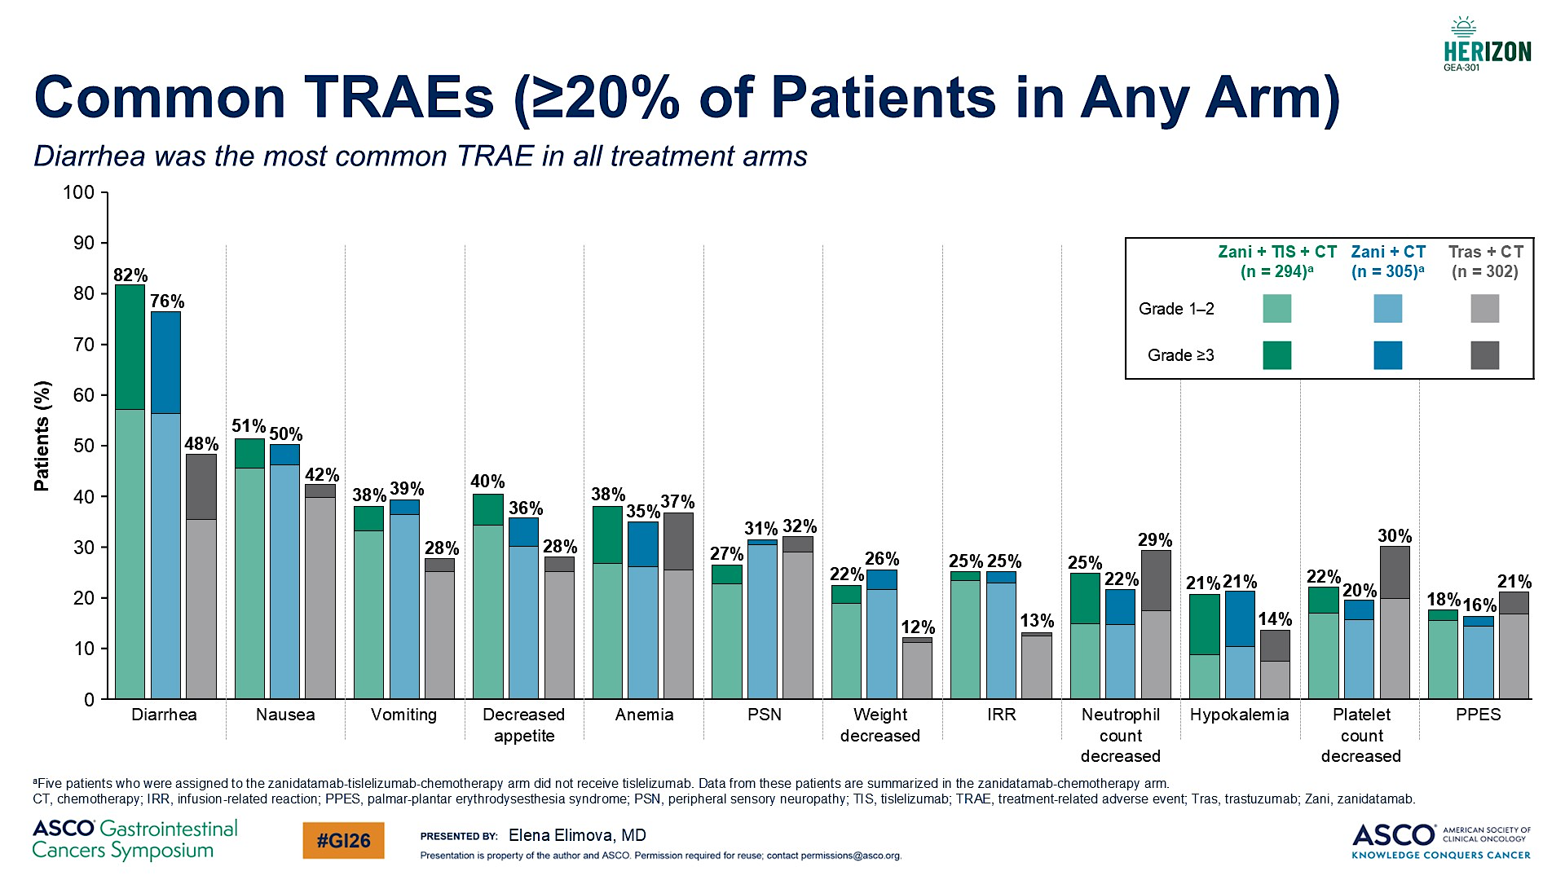

Slide 35
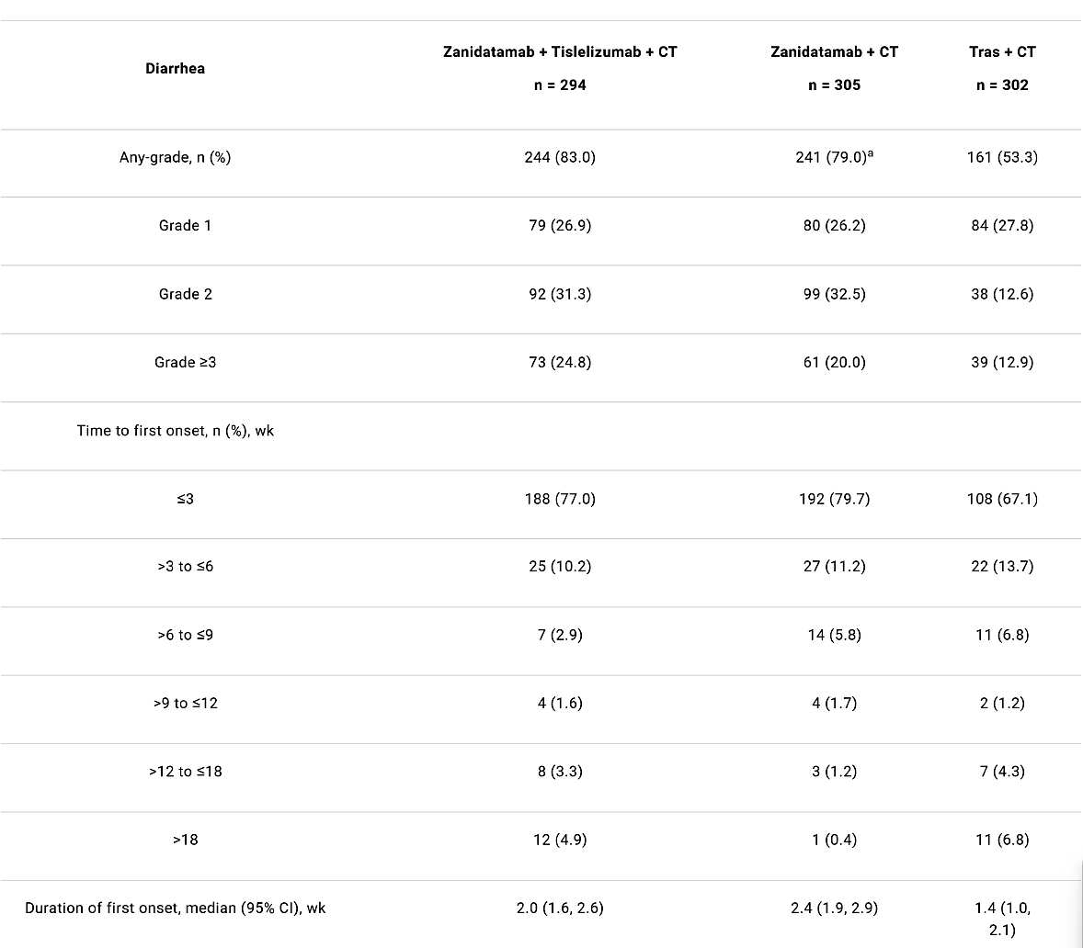
Characterization of gastrointestinal adverse events
In zanidatamab-treated pts, most diarrhea events were grade 1/2, and first-onset events tended to occur in cycle 1 and resolved in <3 wk.
Diarrhea rarely led to zanidatamab discontinuation.
The safety of zanidatamab-containing regimens appears favorable given the survival benefits;
Diarrhea should be managed with prophylactic loperamide and CT dose modifications as needed.
Elimova E et al, ASCO 2026, A 4042

Slide 36
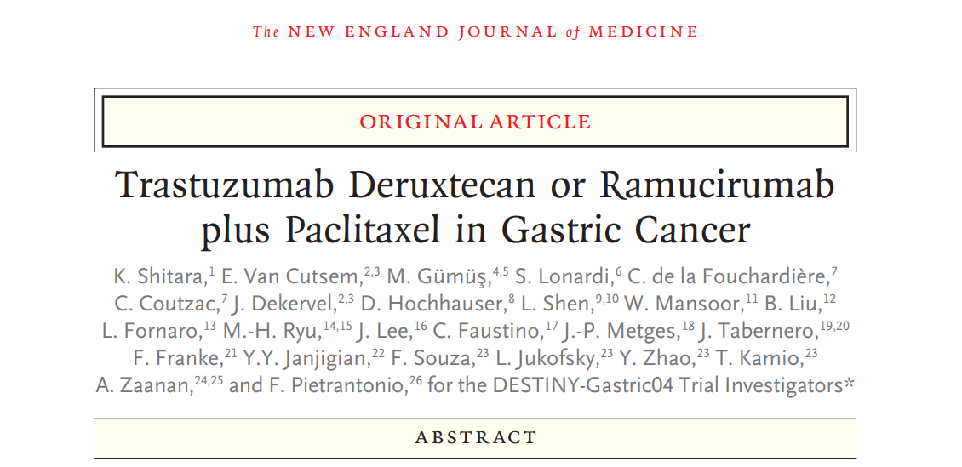
Study Design
DESTINY-Gastric04: A Global, Multicenter, Randomized, Phase 3 Trial (NCT04704934)
Patient Population
HER2+ (IHC 3+ or IHC 2+/ISH+)ª GC/GEJA
HER2 status confirmed locally or centrally^{b} on a recent biopsy obtained after progression on trastuzumab
ECOG PS 0 or 1
No clinically active CNS metastases^{c}
T-DXd
6.4 mg/kg Q3W
Primary Endpoint
OS
Secondary Endpoints
PFS (INV)^{e}
Confirmed ORR (INV)^{e}
DCR (INV)^{e}
DOR (INV)^{e}
Safety
Exploratory Endpoints
PRO^{f}
R
1:1
RAM + PTX^{d}
Stratification factors
HER2 status (IHC 3+ vs IHC 2+/ISH+)
Geography (Asia [excluding mainland China] vs Western Europe vs mainland China/rest of world)
Time to progression on 1L therapy (<6 months vs ≥6 months)
ªAs classified by 2018 ASCO/CAP guidelines. ^{b}Study protocol originally mandated HER2 status be determined centrally but was later amended to allow local determination. ^{c}Clinically active CNS metastases were defined as being untreated and symptomatic or requiring therapy with corticosteroids or anticonvulsants. Patients with clinically inactive CNS metastases could be enrolled. ^{d}RAM administered as 8 mg/kg on days 1 and 15 of each 28-day cycle and PTX administered as 80 mg/m² on days 1, 8, and 15 of each 28-day cycle. ^{e}Determined by investigator-based assessment on RECIST v1.1. ^{f}Based on EORTC EQ-5D-5L VAS and FACT-Ga subscales.
Kohei Shitara, MD
New Engl J Med 2025

Slide 37
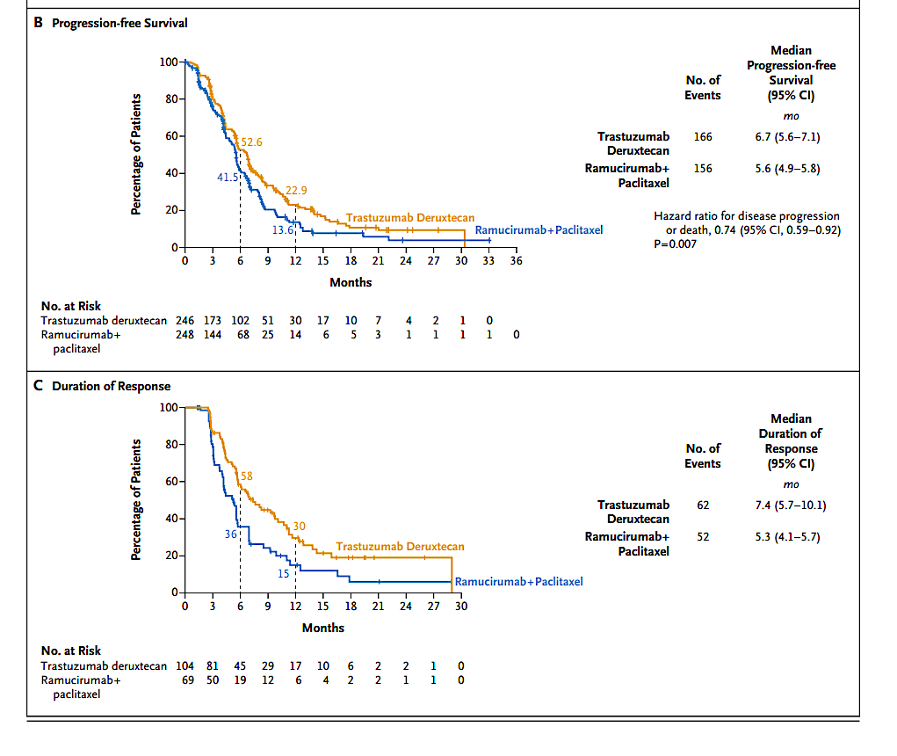
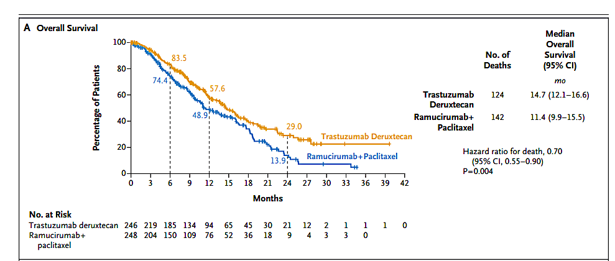
DESTINY-Gastric 04: efficacy
Shitara K, Van Cutsem E et al, NEJM 2025

Slide 38
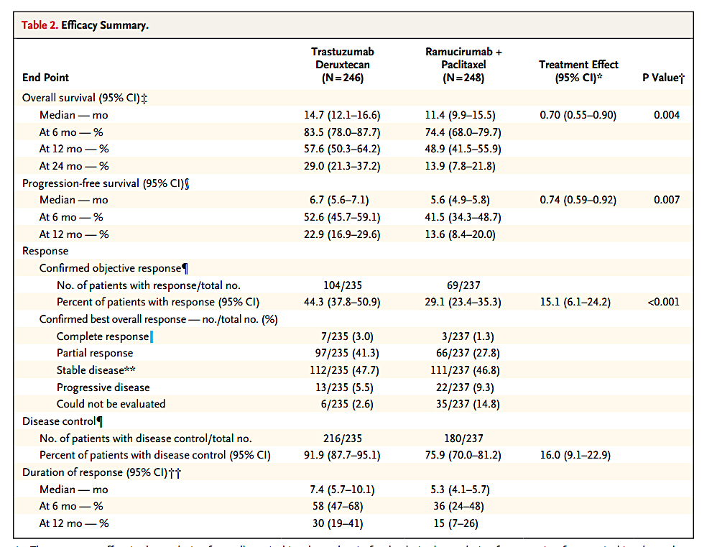
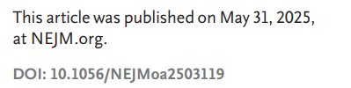
DESTINY-Gastric 04
Shitara K, Van Cutsem E et al

Slide 39
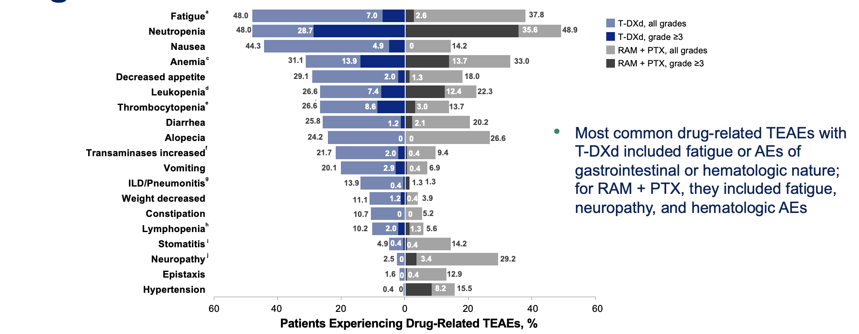
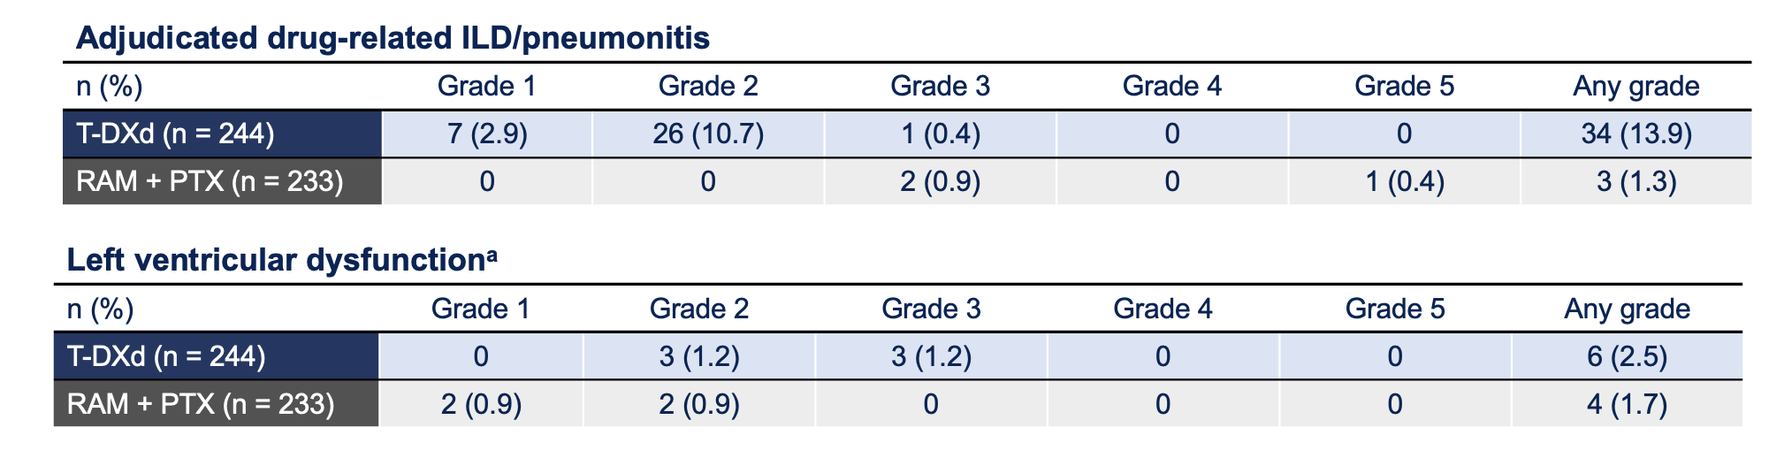
DESTINY-Gastric04: Safety
Drug-related TEAEs in ≥10% of patients
AEs of special interest
ILD/pneumonitis events in the T-DXd arm were mainly low-grade, with no grade 4 or 5 events
Incidence of left ventricular dysfunction was similar across both arms
Most common drug-related TEAEs with T-DXd included fatigue or AEs of gastrointestinal or hematologic nature; for RAM + PTX, they included fatigue, neuropathy, and hematologic AEs.
Shitara K, Van Cutsem E et al, NEJM 2025

Slide 40
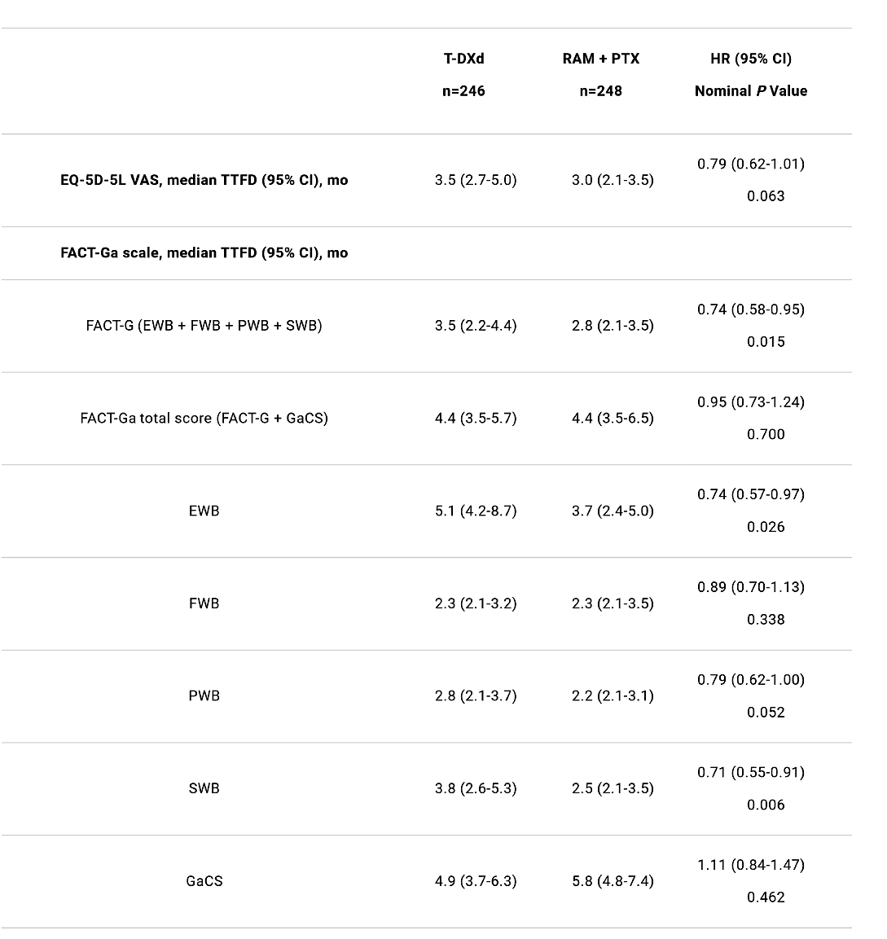
Additional health-related quality of life (HRQoL) analysis from DESTINY-Gastric04 (DG-04),
These findings support patient-reported HRQoL was maintained with T-DXd in pts with HER2+ unresectable/metastatic GC/GEJA.
Time to first deterioration (TTFD) was not negatively impacted with T-DXd
Mean change from baseline (CFB) in all FACT-Ga subscales showed pt symptoms and functioning remained stable, with some subscales favoring T-DXd vs RAM + PTX.
Shitara K,…Van Cutsem et al, ASCO 2026, A4011

Slide 41
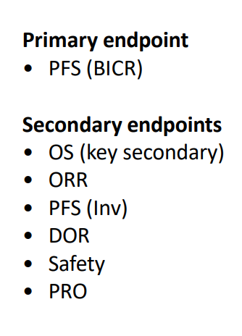
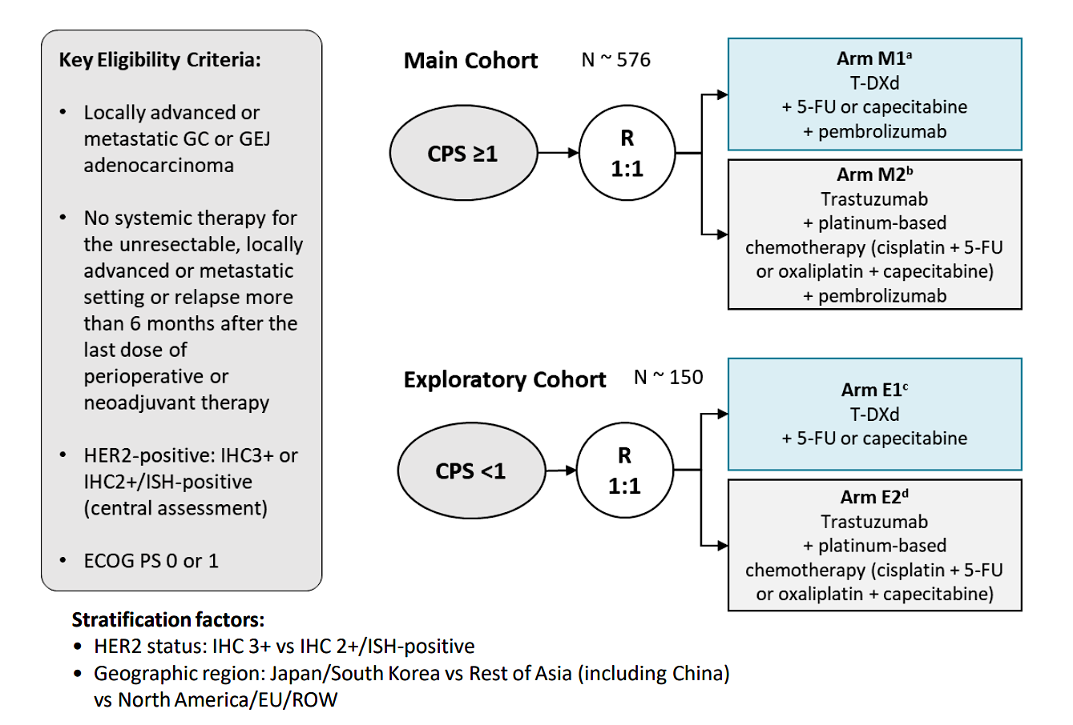
DESTINY-Gastric05: study design
https://clinicaltrials.gov/study/NCT06731478

Slide 42
Chemo +/- Anbenitamab in pretreated advanced
HER2 + gastric adenocarcinoma
Population studied :
GC/GEJC HER2 positive centrally confirmed​
Progression under treatment prior containing trastuzumab
ECOG PS of 0 or 1
Primary objective :
IRC assessed PFS
OS
Secondary objectives:
The IRC and the investigator have assessed the objective response rate (ORR), duration of response ( DoR ), disease control rate ( DCR ), progression-free survival (PFS), and safety.
Anbenitamab 30 mg/kg Q3W and chemotherapy
R
1:1
Placebo
and chemotherapy
Stratification factors :​
Type of chemotherapy (taxanes [paclitaxel and docetaxel ] or irinotecan )
HER2 expression (IHC 3+ or IHC2+/FISH+)
Number of previous lines (1 or ≥2)
Xu J et al., ESMO 2025, Abs #LBA78; Liu R et al, Ann Onc 2026

Slide 43
Chemo +/- Anbenitamab in pretreated advanced
HER2 + gastric adenocarcinoma
Compared with chemotherapy alone, anbenitamab plus chemotherapy significantly reduced the risk of death by 71%, meeting the predefined statistical criterion (alpha threshold of 0.00001).
 | OSm , mo, 95% CI | HR (95% CI) | p-value
Anbenitamab | 19.6 (15.0-NE) | 0.29 (0.17-0.50) | 1.56 x 10 ⁻⁶
Control | 11.5 (6.5-14.4)
94.9%
79.1%
67.7%
66.4%
Anbenitamab
Probability of survival
48.0%
47.3%
27.9%
Control
Months after randomization​
Positive study with impressive results of Anbenitamab efficacy.
To be confirmed in non-Asian population
Xu J et al., ESMO 2025, Abs #LBA78; Liu R et al, Ann Onc 2026

Slide 44
Regulatory and reimbursement issues aside, what first-line treatment would you most likely recommend for a 65-year-old patient presenting with metastatic
CLDN18.2-negative, HER2-positive, MSS gastric adenocarcinoma with PD-L1 CPS 0?
Zanidatamab/chemotherapy
Zanidatamab/chemotherapy
FOLFOX/trastuzumab
Zanidatamab/chemo/tislelizumab
Zanidatamab/chemo ± tislelizumab
Zanidatamab/chemo/tislelizumab
MSS = microsatellite-stable; CPS = combined positive score

Slide 45
Regulatory and reimbursement issues aside, what first-line treatment would you most likely recommend for a 65-year-old patient presenting with metastatic
CLDN18.2-negative, HER2-positive, MSS gastric adenocarcinoma with PD-L1 CPS 1?
Zanidatamab/chemo/tislelizumab
Zanidatamab/chemo/tislelizumab
Zanidatamab/chemo/tislelizumab
Zanidatamab/chemo/tislelizumab
Zanidatamab/chemo/tislelizumab
Trastuzumab/chemo/pembrolizumab
MSS = microsatellite-stable; CPS = combined positive score

Slide 46
For a patient for whom you have elected to employ zanidatamab/chemotherapy in combination with an anti-PD-1 antibody, how will you approach the selection of anti-PD-1 antibody?
I will use any of the anti-PD-1 antibodies
I will use any of the anti-PD-1 antibodies
I will use tislelizumab per the trial
I will use tislelizumab per the trial
I will use any of the anti-PD-1 antibodies
I will use tislelizumab per the trial

Slide 47
In general, which targeted strategy would you prioritize for a patient with newly diagnosed CLDN18.2-positive, HER2-positive gastric/GEJ adenocarcinoma?
HER2-targeted therapy
HER2-targeted therapy
HER2-targeted therapy
HER2-targeted therapy
HER2-targeted therapy
HER2-targeted therapy

Slide 48
What preemptive treatment, if any, are you recommending to prevent gastrointestinal toxicities with zanidatamab?
Loperamide, tramadol
Loperamide
Loperamide
Loperamide
Loperamide
Loperamide

Slide 49
Faculty Discussion
Regulatory and reimbursement issues aside, what first-line treatment would you most likely recommend for a 65-year-old patient presenting with metastatic CLDN18.2-negative, HER2-positive, MSS gastric adenocarcinoma with PD-L1 CPS 0? PD-L1 CPS 1?
For a patient for whom you have elected to employ zanidatamab/chemotherapy in combination with an anti-PD-1 antibody, how will you approach the selection of anti-PD-1 antibody?
In general, which targeted strategy would you prioritize for a patient with newly diagnosed CLDN18.2-positive, HER2-positive gastric/GEJ adenocarcinoma?
What preemptive treatment, if any, are you recommending to prevent gastrointestinal toxicities with zanidatamab?

Slide 50
Regulatory and reimbursement issues aside, what would you most likely recommend as second-line therapy for a patient with metastatic CLDN18.2-negative, HER2-positive, MSS gastric adenocarcinoma, a PD-L1 CPS of ≥1 and PD on zanidatamab/chemotherapy/tislelizumab?
Trastuzumab deruxtecan
Trastuzumab deruxtecan
Trastuzumab deruxtecan
Trastuzumab deruxtecan
Trastuzumab deruxtecan
Trastuzumab deruxtecan

Slide 51
Outside of a clinical trial, would you offer zanidatamab to a patient with
HER2-pos­itive gastric/GEJ adenocarcinoma who had PD on first-line FOLFOX/trastuzumab/pembrolizumab and second-line trastuzumab deruxtecan?
No
No
No
Yes
Yes
Yes

Slide 52
Outside of a clinical trial, have you administered or would you administer trastuzumab deruxtecan to a patient with HER2-low (IHC 2+ or 1+) gastric/GEJ adenocarcinoma?
I have not but would for the right patient
I have not but would for the right patient
I have not and would not
I have not but would for the right patient
I have not and would not
I have not and would not

Slide 53
Faculty Discussion
Regulatory and reimbursement issues aside, what would you most likely recommend as second-line therapy for a patient with metastatic CLDN18.2-negative, HER2-positive, MSS gastric adenocarcinoma, a PD-L1 CPS of ≥1 and PD on zanidatamab/chemotherapy/tislelizumab?
Outside of a clinical trial, would you offer zanidatamab to a patient with
HER2-pos­itive gastric/GEJ adenocarcinoma who had PD on first-line FOLFOX/trastuzumab/pembrolizumab and second-line trastuzumab deruxtecan?
Outside of a clinical trial, have you administered or would you administer trastuzumab deruxtecan to a patient with HER2-low (IHC 2+ or 1+) gastric/GEJ adenocarcinoma?

Slide 54
Agenda
Module 1: HER2-Targeted Approaches in Advanced Gastroesophageal Cancers —Prof Van Cutsem
Module 2: Targeting CLDN18.2 in Advanced Gastroesophageal Cancers — Dr Shah
Module 3: Available Immunotherapeutic Strategies for Advanced Gastroesophageal Cancers — Dr Janjigian

Slide 55

The Evolving Role of Targeting CLDN18.2 in Gastroesophageal Cancers
Research To Practice Satellite Symposium
May 29, 2026
Manish A. Shah, MD
@MDManishShah

Slide 56
Key Biomarkers in Gastroesophageal Cancer
Key markers in advanced disease
HER2 positive: 15%-20% of patients; improved survival with chemo + HER2-targeting trastuzumab
MSI high: 3%-5% of patients, high response rates to immunotherapies ± chemo
PD-L1 positive: 30%-50% of patients; identifies those more likely to benefit from immunotherapy; likely gradation within PD-L1+ (CPS)
CLDN18.2 high: 30%-35% of patients; response predictor for CLDN18.2-targeting agent
Investigational biomarkers
FGFR2 amp: 5%-10% of patients; multiple trials of inhibitors
FGFR2 high: May be up to 30% of HER2 negative
EGFR amp: 5%-7%; may predict response to EGFR agents
Tumor agnostic
Mismatch repair deficiency (or MSI-H)
Tumor mutation burden
NTRK fusion
AMP = amplification; CPS = combined positive score; EGFR = epidermal growth factor receptor; FGFR2 = fibroblast growth factor receptor 2; HER = human epidermal growth factor receptor
Kuwata T. Pathol Int. 2024; online ahead of print
.

Slide 57
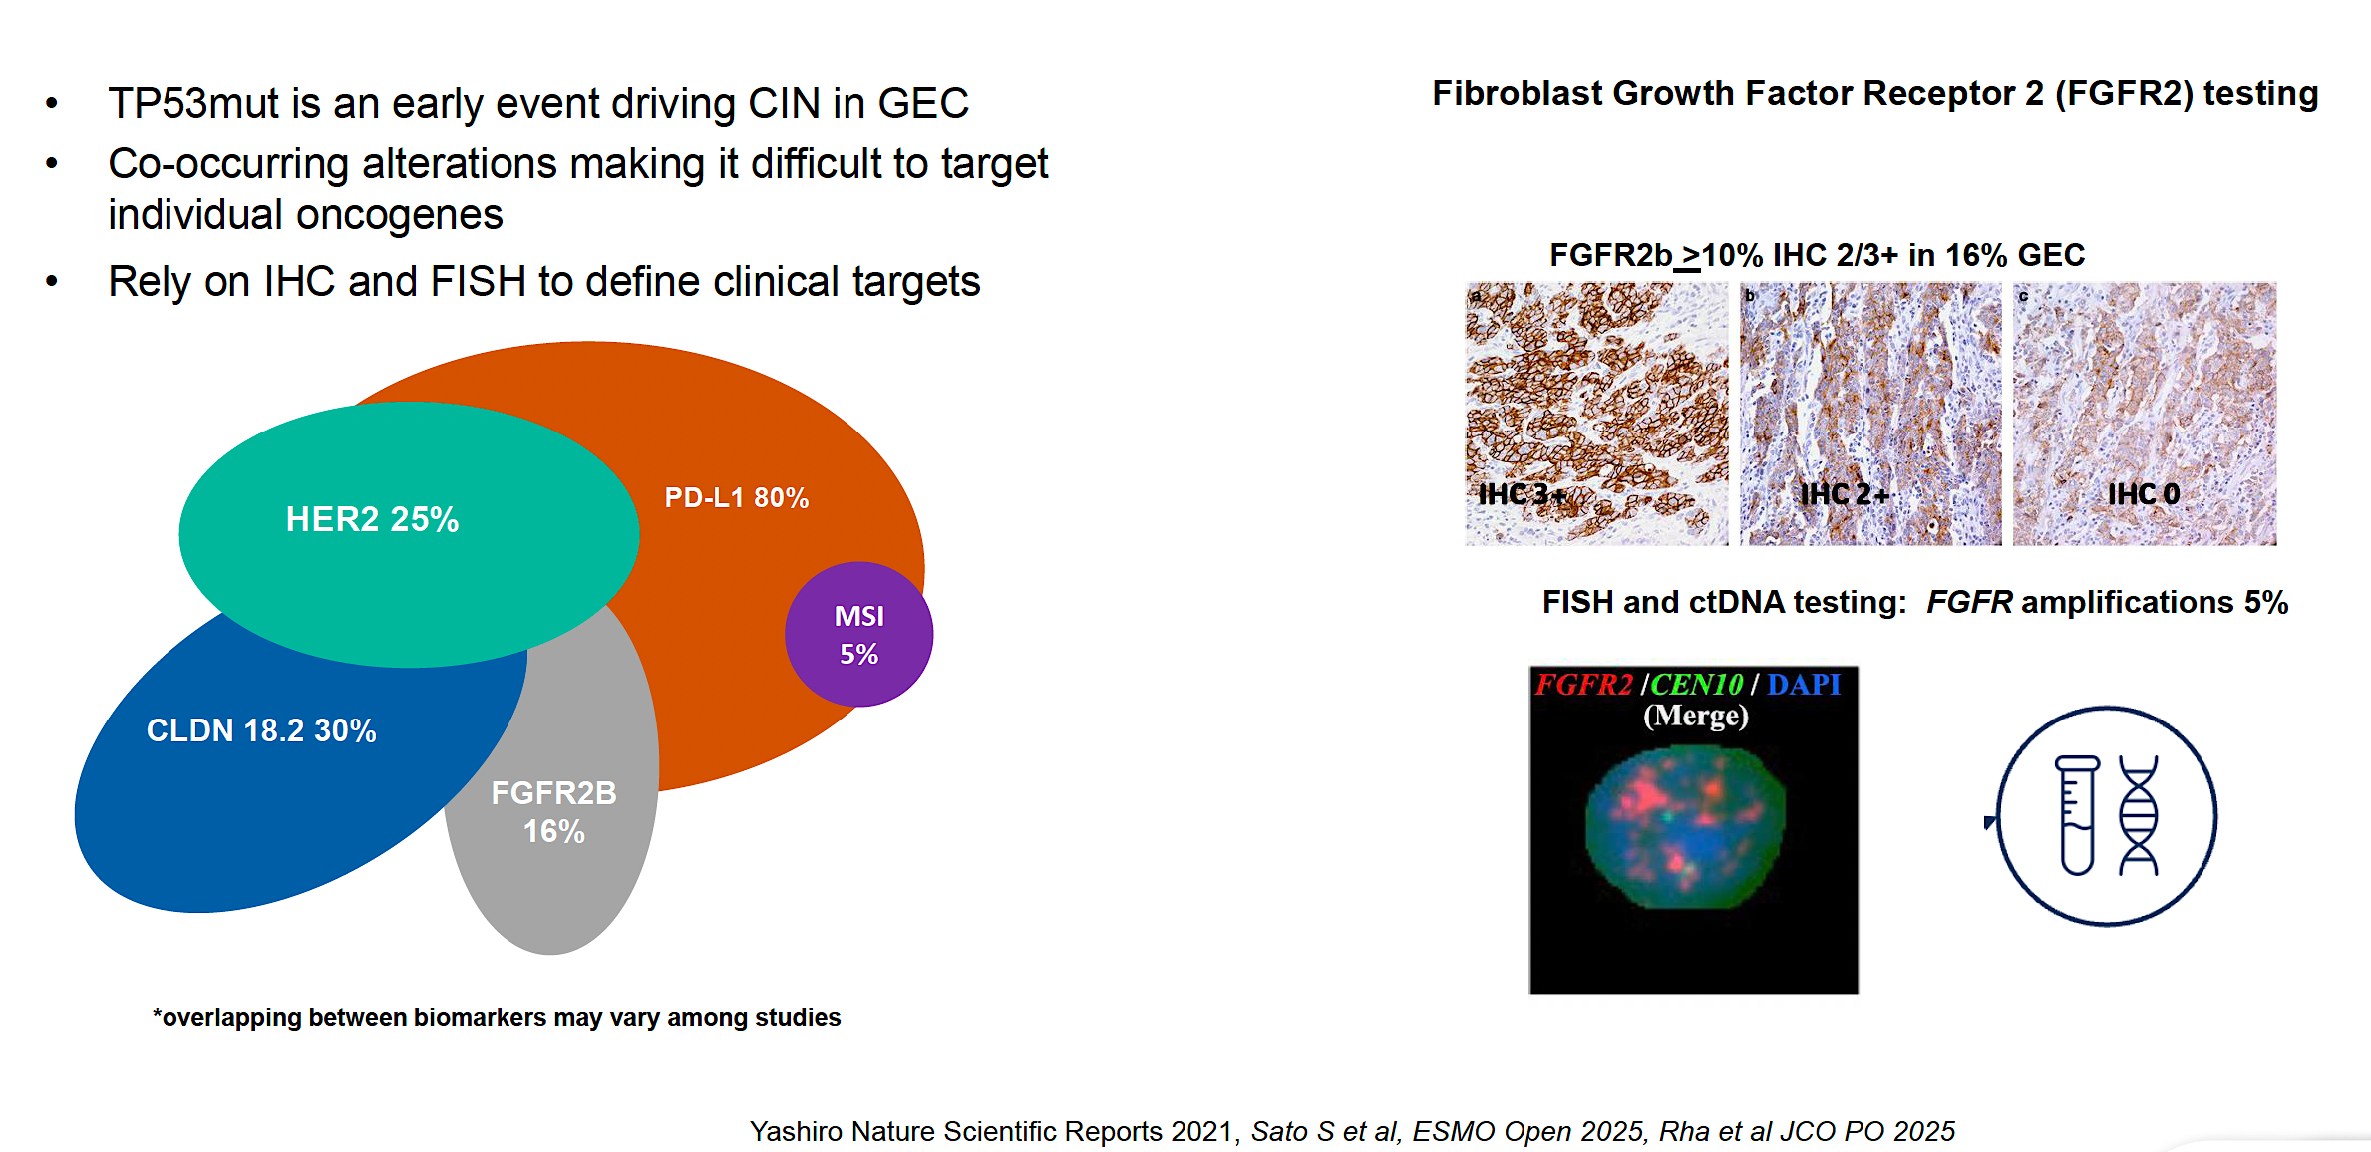
Biomarkers don’t neatly fit in a pie!

Slide 58
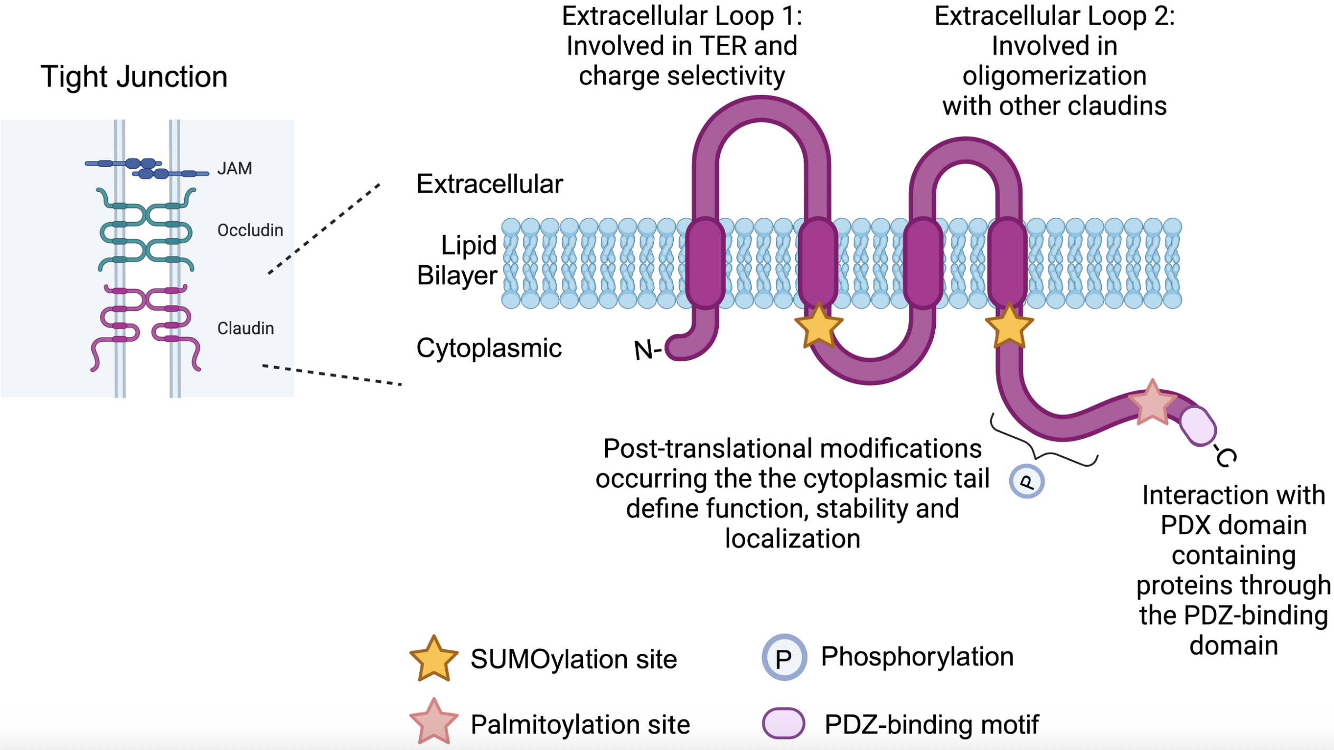
Claudin 18.2 – A New Target in Upper GI Cancers
Claudin proteins are a major structural component of tight junctions
There are different claudins that can be targeted
on
CLDN18.2 – upper GI/ Panc
CLDN 6 – oncofetal protein (ovary/ endometrial/ testicular)
Vonniessen Front Oncol 2024

Slide 59
Claudin18.2: Leveraging Biology
Normal Gastric Epithelia
Gastric Cancer
Luminal
Luminal
Malignant
Transformation
Claudin18.2 is a major structural component of intercellular tight junctions
Not routinely expressed in any normal tissue outside gastric mucosa (cancer-restricted antigen)
Broadly expressed in several tumor types including gastric, GEJ, biliary, and pancreatic
Baek. Anticancer Res. 2019;39:6973.

Slide 60
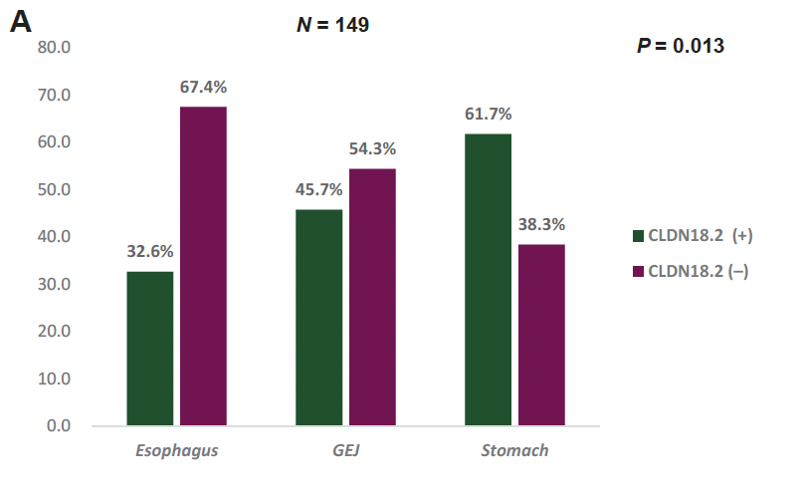
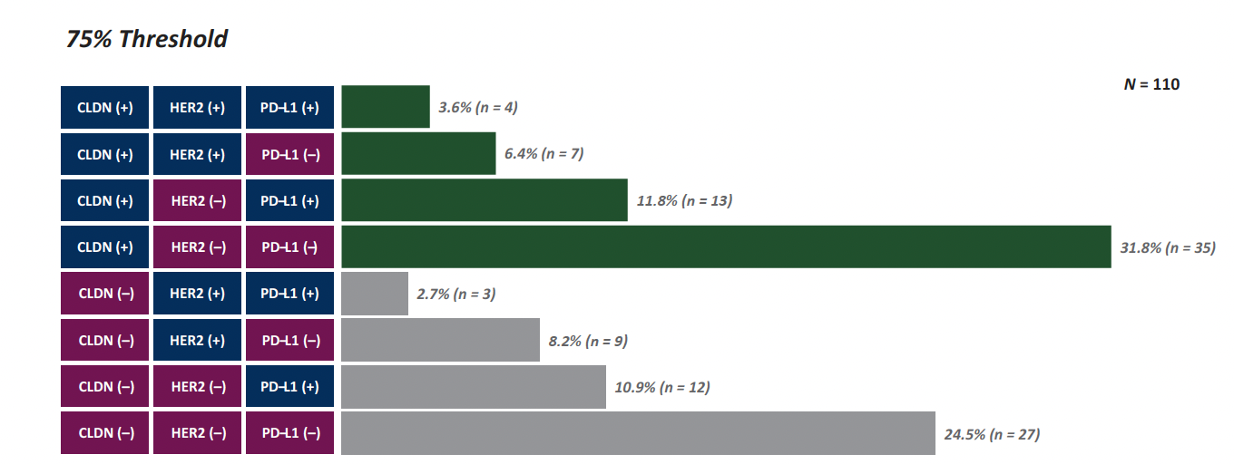
Claudin18.2: Characteristics and Overlap
More prevalent in GC
~30% sole biomarker
Maeng et al. ESMO Gastro Onc 2026

Slide 61
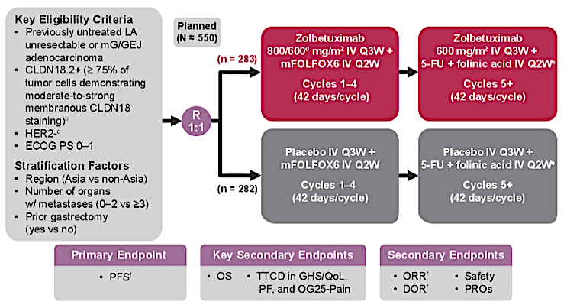
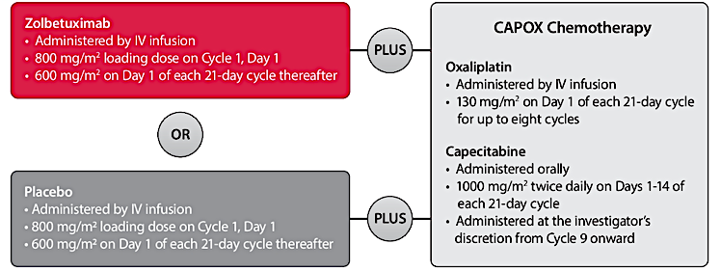
SPOTLIGHT/GLOW Study Design
SPOTLIGHT
GLOW
Shitara K et al. N Engl J Med. 2024;391(12):1159-1163.

Slide 62
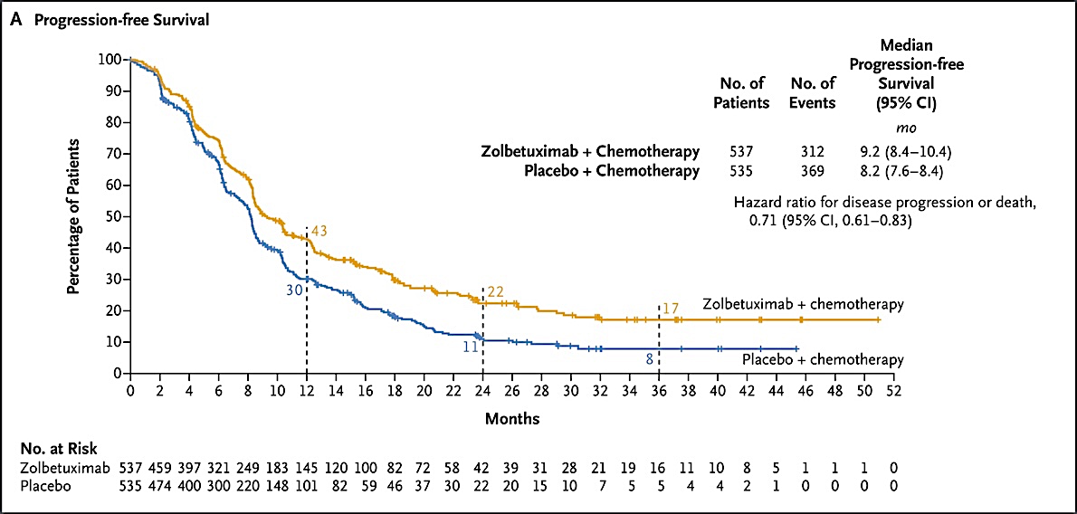
SPOTLIGHT/GLOW Combined PFS
Shitara K et al. N Engl J Med. 2024;391(12):1159-1163.

Slide 63
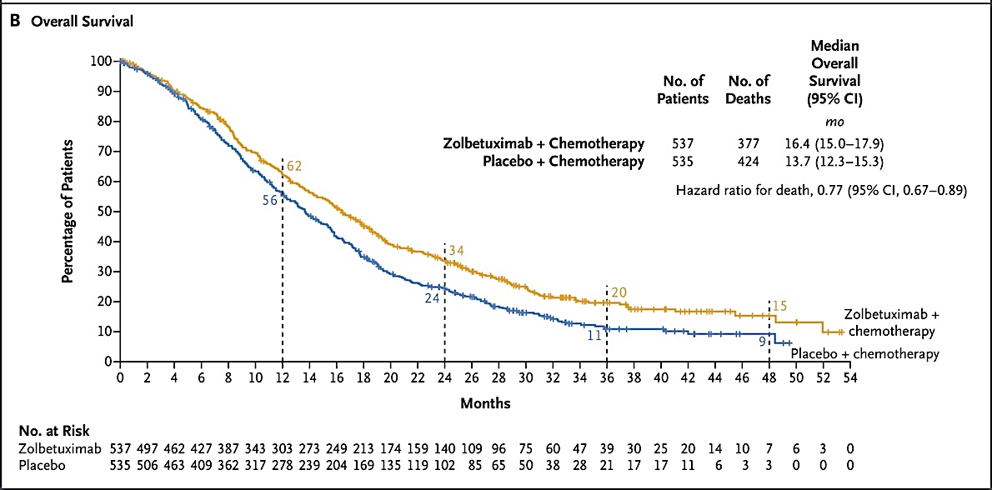
SPOTLIGHT/GLOW Combined OS
Shitara K et al. N Engl J Med. 2024;391(12):1159-1163.

Slide 64
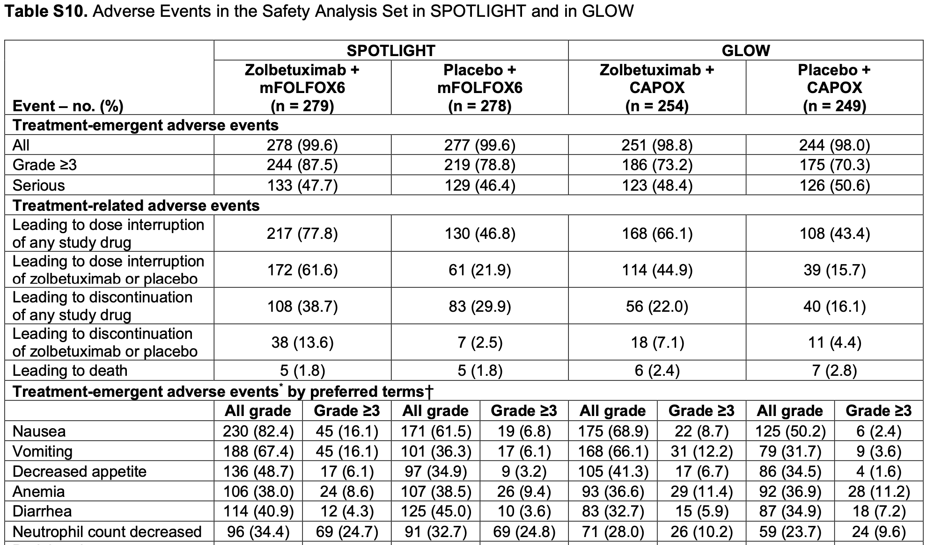
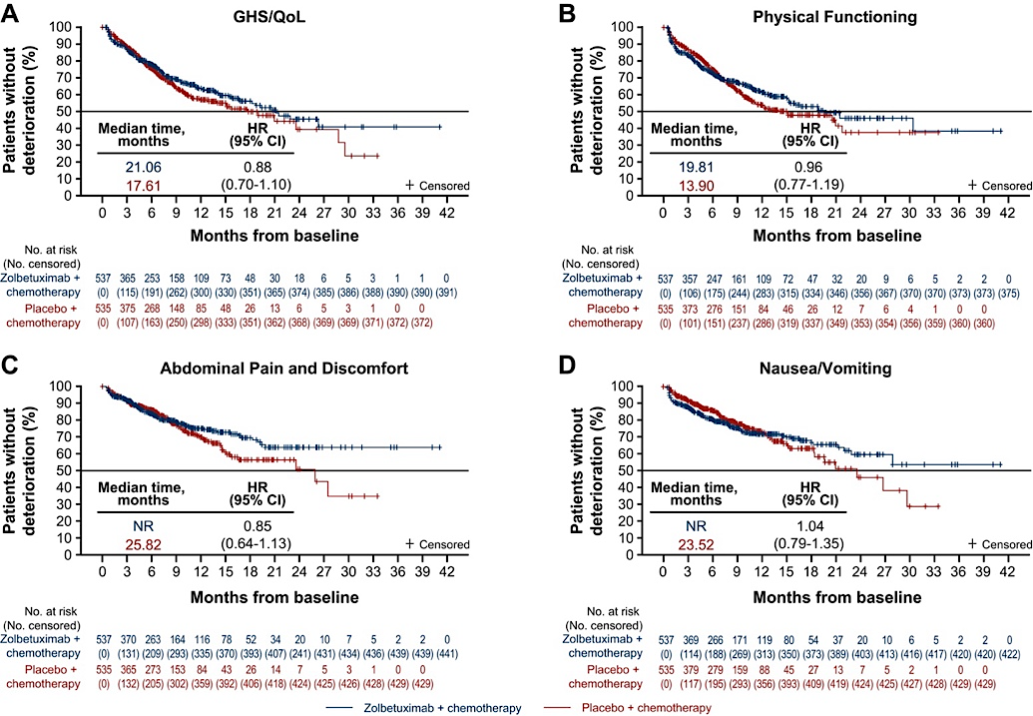
SPOTLIGHT/GLOW Adverse Events
Change from baseline trends for key PRO domains were similar with zolbetuximab + chemotherapy and placebo + chemotherapy.
Nausea/vomiting worsened in early cycles but later returned to baseline levels without clinically meaningful deterioration.
Shitara K et al. N Engl J Med. 2024;391(12):1159-1163; Lordick F et al. ESMO Open. 2024;9(8):103663.

Slide 65
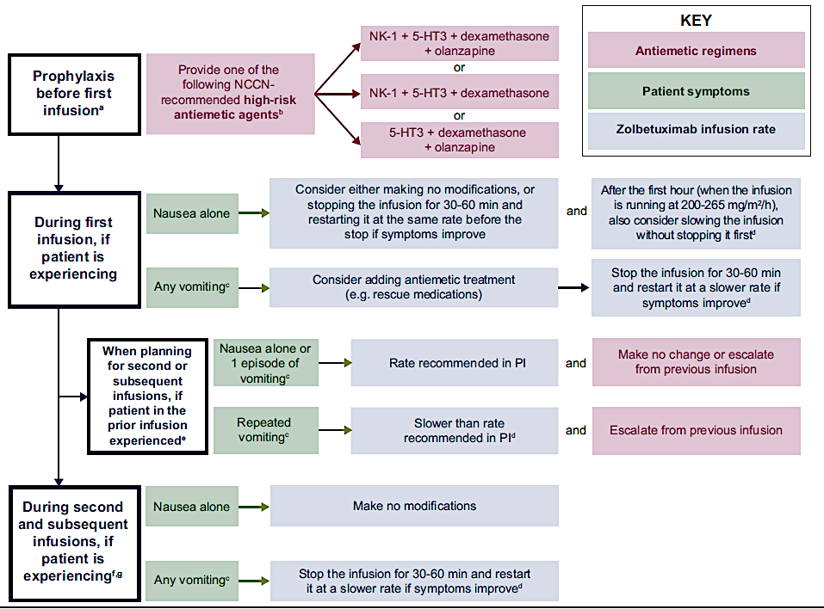
Zolbetuximab: Management of Nausea and Vomiting
Klempner SJ et al. ESMO Gastro Oncol. 2025;7:100131.

Slide 66
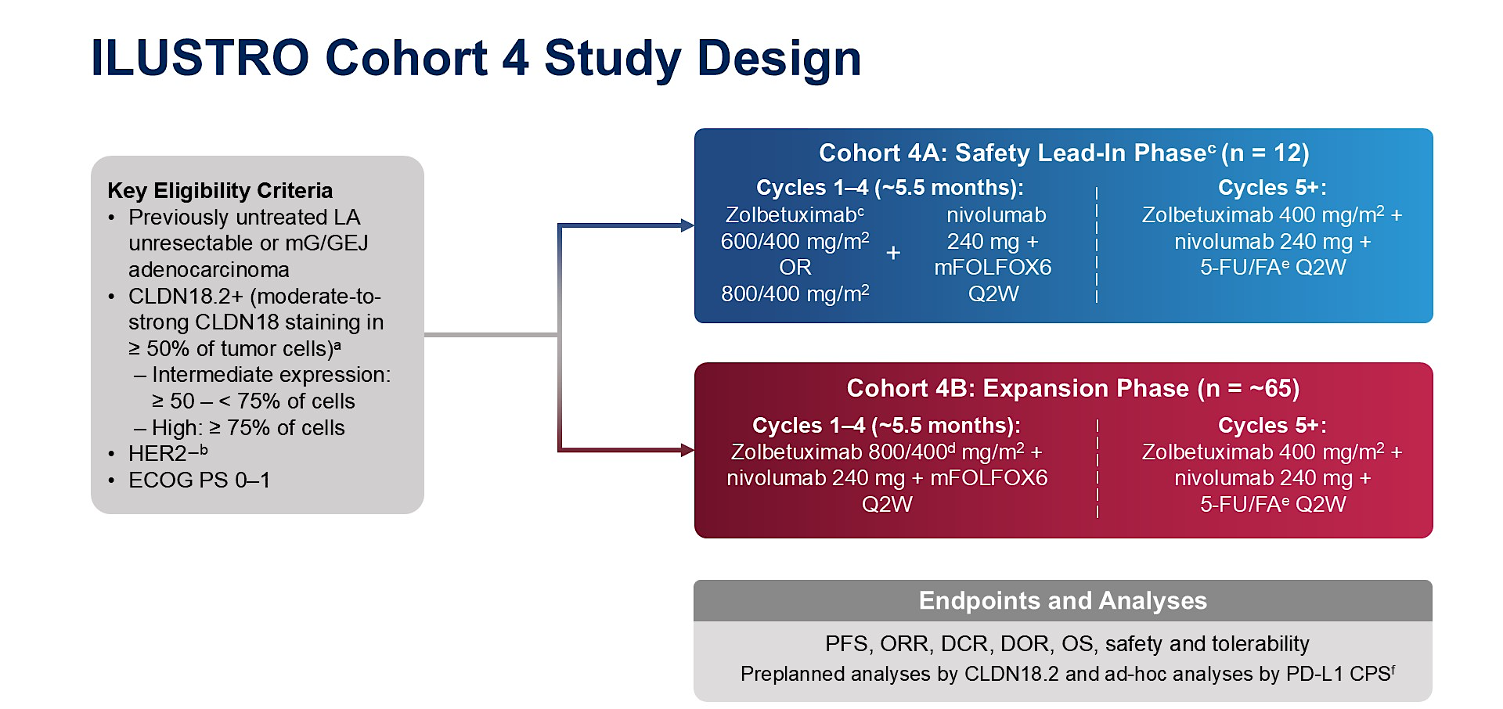
Shitara ASCO GI 2026, Abs 284

Slide 67
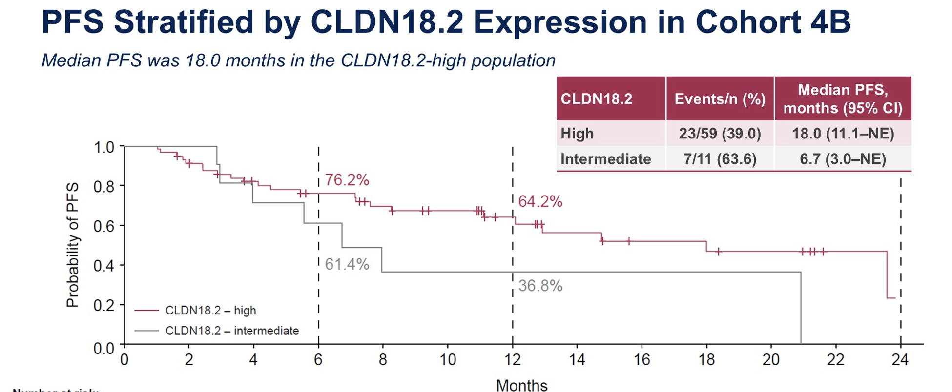
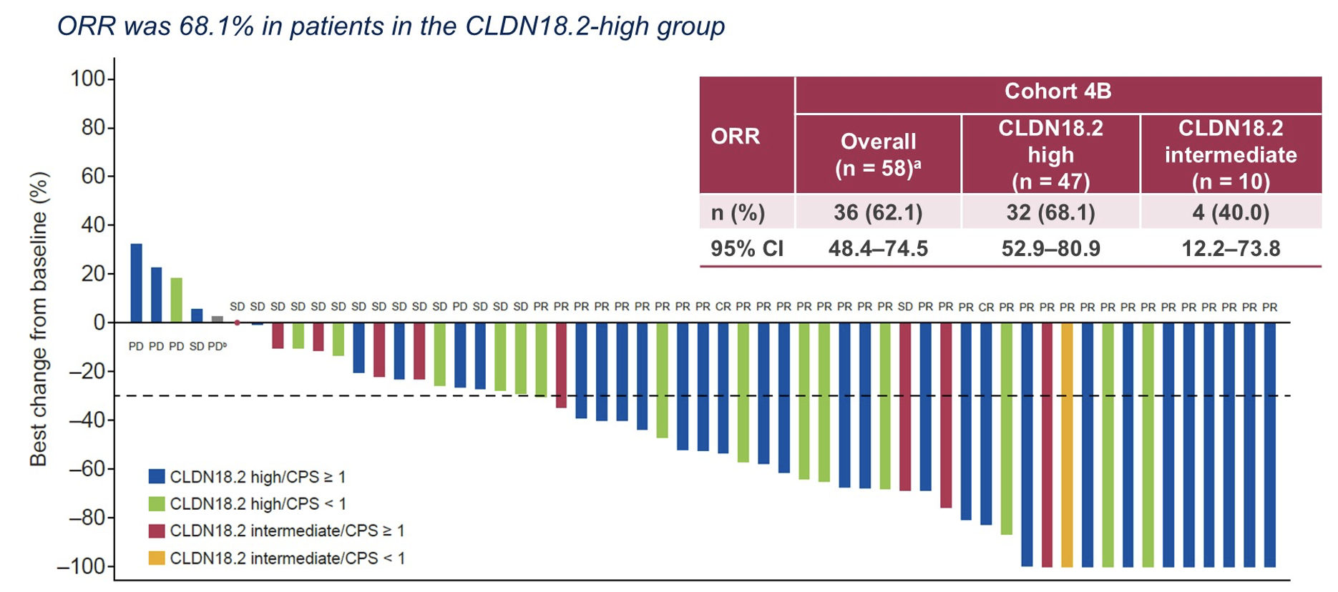
Shitara ASCO GI 2026, Abs 284

Slide 68
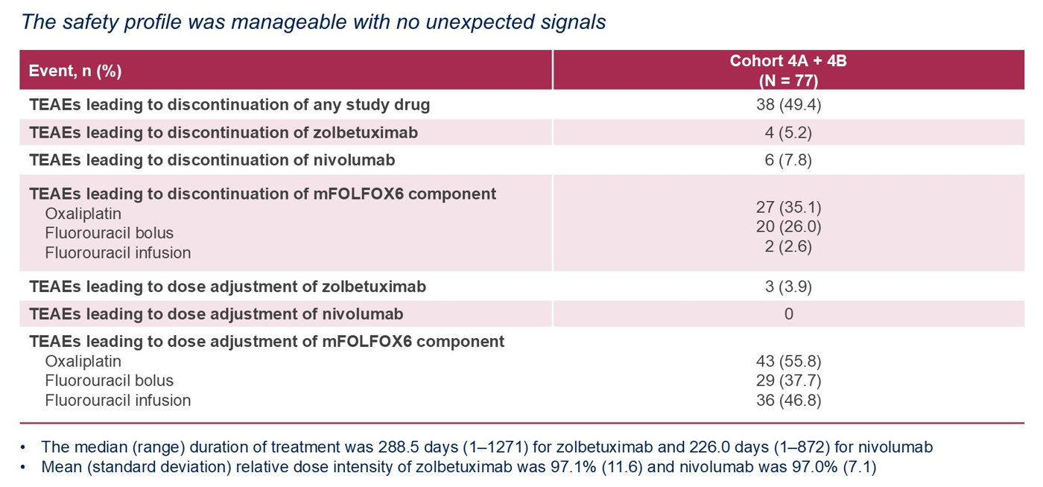
ILUSTRO Safety Profile in Cohorts 4A + 4B
Courtesy of Dr. Samuel Klempner
Shitara K et al. ASCO GI 2026. LBA284

Slide 69
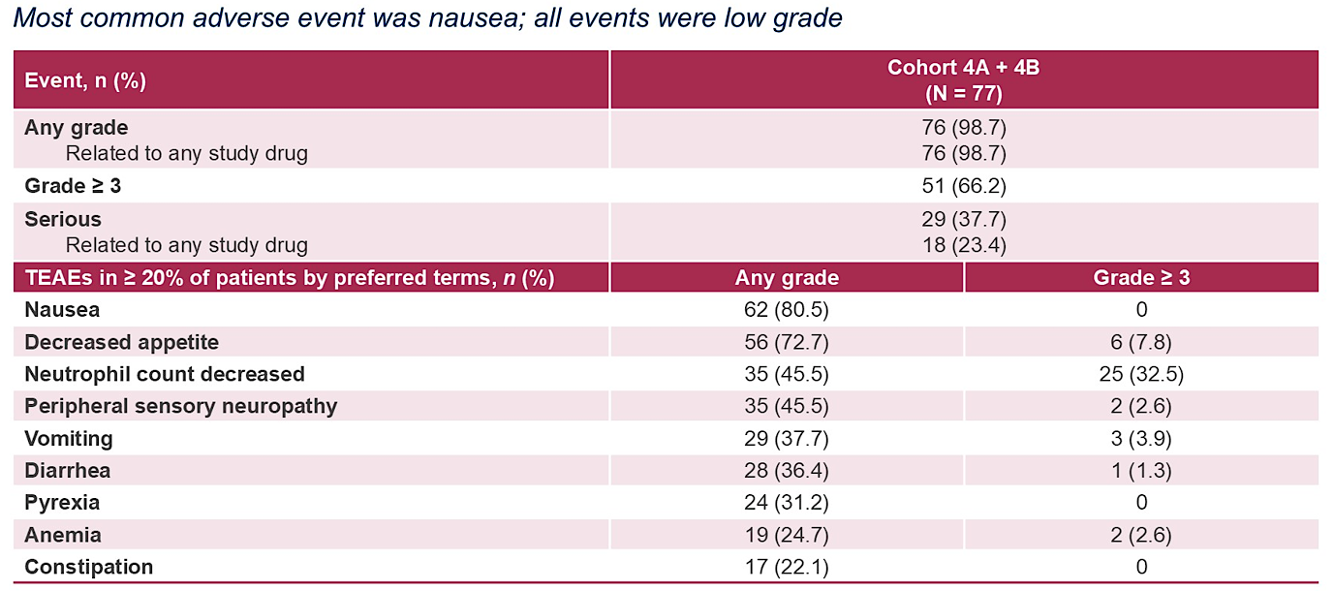
ILUSTRO TEAEs in ≥20% of Patients in All Treated Patients from Cohorts 4A + 4B
Courtesy of Dr. Samuel Klempner
Shitara K et al. ASCO GI 2026. LBA284

Slide 70
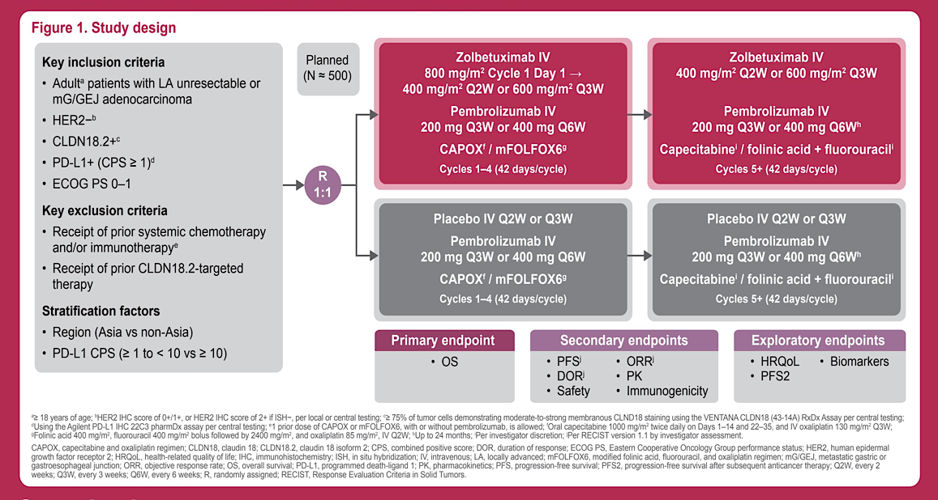
Phase 3 LUCERNA Study
Shitara et al. ASCO GI 2026

Slide 71
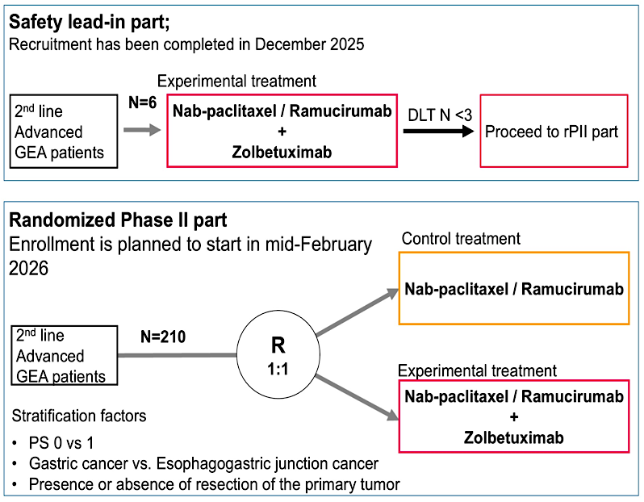
Phase I/II ZELDA Study
Ando K et al. ASCO GI 2026

Slide 72
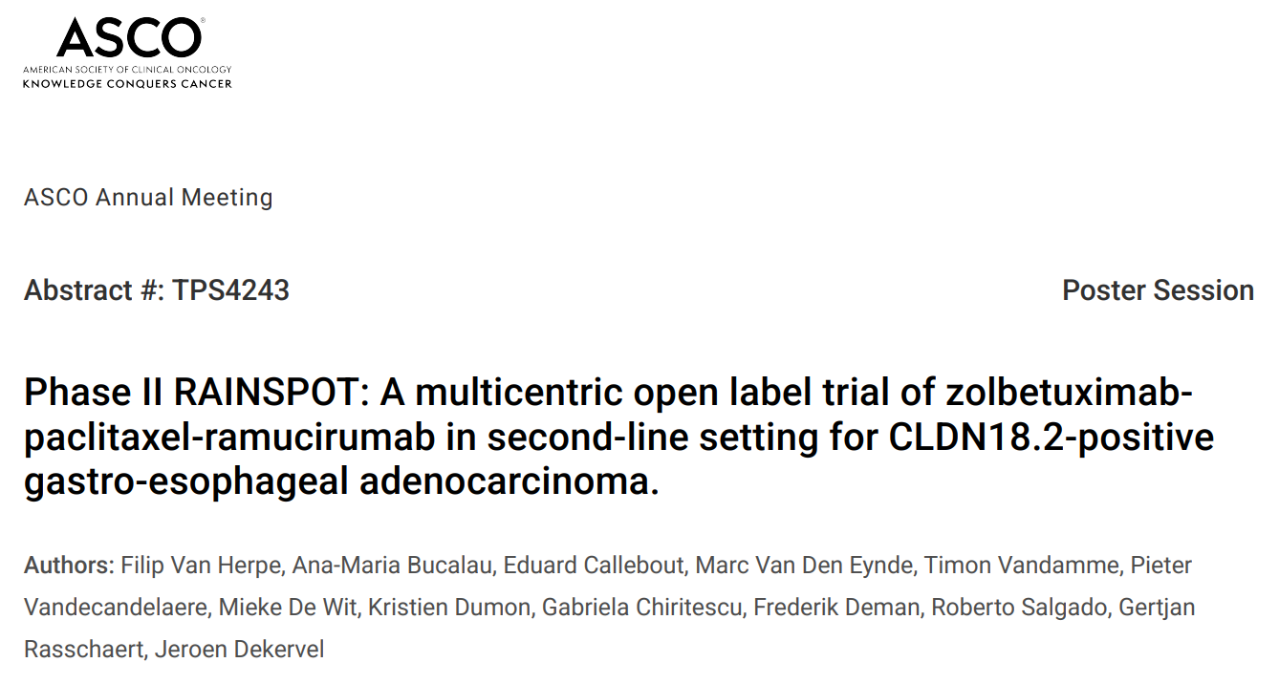
Shitara K et al. ASCO GI 2026. LBA284

Slide 73
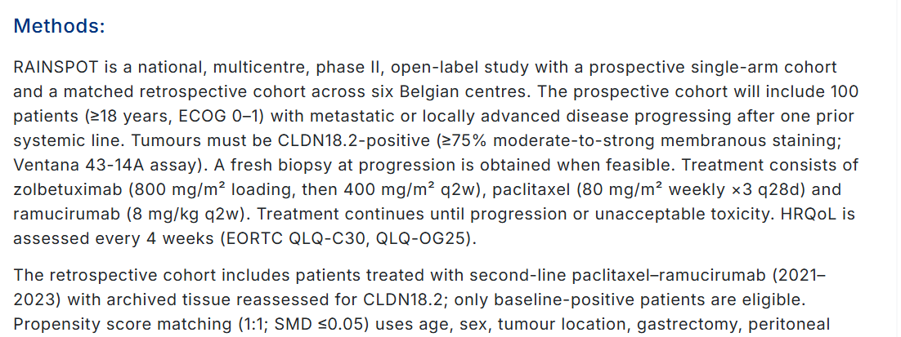
Shitara K et al. ASCO GI 2026. LBA284

Slide 74
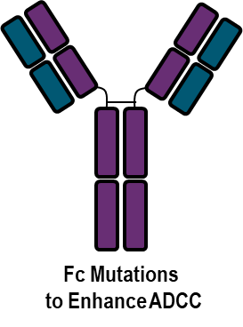
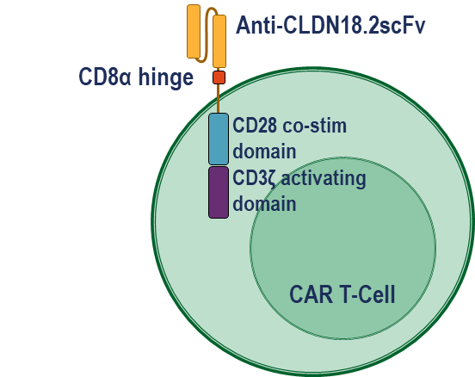


CLDN18.2 Targeted Therapies
Monoclonal antibody
- Humanized mAb
- Engineered mAb
CAR-T
Bispecific
ADCs
CMG901, EO-3021
TORL-2800
TPX4589
RC118
LM302
SOT102
SKB315
JS107
IBI343
Zolbetuximab
TST-001
ABI011, MIL93, ZL1211 etc.
CT-041
LCAR-C18S
LY011
AMG910/ASP2138 (CD3)
TJ-CD4B (4-1BB)
PT886 (CD47)
Q-1802 (PD-L1)
IBI 389

Slide 75
Regulatory and reimbursement issues aside, what first-line treatment would you most likely recommend for a 65-year-old patient presenting with metastatic
CLDN18.2-positive, HER2-negative, MSS gastric adenocarcinoma with PD-L1 CPS 0?
Chemotherapy + zolbetuximab
Chemotherapy + zolbetuximab
Chemotherapy + zolbetuximab
Chemotherapy + zolbetuximab
Chemotherapy + zolbetuximab
Chemotherapy + zolbetuximab
MSS = microsatellite-stable; CPS = combined positive score

Slide 76
Regulatory and reimbursement issues aside, what first-line treatment would you most likely recommend for a 65-year-old patient presenting with metastatic
CLDN18.2-positive, HER2-negative, MSS gastric adenocarcinoma with PD-L1 CPS 1?
Chemotherapy + anti-PD-1/PD-L1 antibody
Chemotherapy + zolbetuximab
Chemotherapy + zolbetuximab
Chemotherapy + zolbetuximab
Chemotherapy + zolbetuximab and anti-PD-1/PD-L1 antibody
Chemotherapy + zolbetuximab and anti-PD-1/PD-L1 antibody
MSS = microsatellite-stable; CPS = combined positive score

Slide 77
Regulatory and reimbursement issues aside, what first-line treatment would you most likely recommend for a 65-year-old patient presenting with metastatic
CLDN18.2-positive, HER2-negative, MSS gastric adenocarcinoma with PD-L1 CPS 10?
Chemotherapy + anti-PD-1/PD-L1 antibody
Chemotherapy + anti-PD-1/PD-L1 antibody
Chemotherapy + anti-PD-1/PD-L1 antibody
Chemotherapy + anti-PD-1/PD-L1 antibody
Chemotherapy + anti-PD-1/PD-L1 antibody
Chemotherapy + zolbetuximab and anti-PD-1/PD-L1 antibody
MSS = microsatellite-stable; CPS = combined positive score

Slide 78
Faculty Discussion
Regulatory and reimbursement issues aside, what first-line treatment would you most likely recommend for a 65-year-old patient presenting with metastatic CLDN18.2-positive, HER2-negative, MSS gastric adenocarcinoma with PD-L1 CPS 0? PD-L1 CPS 1? PD-L1 CPS 10?

Slide 79
How would you indirectly compare the global effi­cacy of zolbetuximab and chemotherapy to that of an anti-PD-1 antibody and chemotherapy for patients with newly diagnosed gastric/GEJ adenocarcinoma who are eligible for both treatments?
An anti-PD-1 antibody/chemotherapy is more efficacious
About the same
About the same
An anti-PD-1 antibody/chemotherapy is more efficacious
About the same
About the same

Slide 80
What pre­medication(s), if any, do you generally recommend for a patient who is about to begin treatment with zolbetuximab?
Standard quadruple regimen
Full antiemetics: ondansetron, aprepitant, steroids
Triple antiemetic: steroid (dexamethasone), 5HT3 and NK1 receptor blocker (+ evt olanzapine)
IV aprepitant, palonsetron, dexamethasone and olanzapine
Palonsetron IV, dexamethasone IV, fosaprepitant IV, olanzapine or lorazepam added commonly, and sometimes IV diphenhydramine
The kitchen sink!

Slide 81
Outside of a clinical trial, have you administered or would you administer both zolbetuximab and an anti-PD-1/PD-L1 antibody in combination with first-line chemotherapy for a patient with newly diagnosed gastric/GEJ adenocarcinoma?
I have
I have not and would not
I have not and would not
I have not but would for the right patient
I have
I have

Slide 82
In which situations, if any, would you attempt to employ zolbetuximab as second- or later-line treatment, and what would you feel comfortable combining it with?
None
For high CLDN18.2 expressors, after 2nd line
Generally none — no data
Unlikely
Rare situations due to lack of data
After progression on FOLFOX/nivolumab, I have done with 5-FU

Slide 83
Faculty Discussion
How would you indirectly compare the global effi­cacy and tolerability of zolbetuximab and chemotherapy to that of an anti-PD-1 antibody and chemotherapy for patients with newly diagnosed gastric/GEJ adenocarcinoma who are eligible for both treatments?
What pre­medication(s), if any, do you generally recommend for a patient who is about to begin treatment with zolbetuximab?
Outside of a clinical trial, have you administered or would you administer both zolbetuximab and an anti-PD-1/PD-L1 antibody in combination with first-line chemotherapy for a patient with newly diagnosed gastric/GEJ adenocarcinoma?
In which situations, if any, would you attempt to employ zolbetuximab as second- or later-line treatment, and what would you feel comfortable combining it with?

Slide 84
Agenda
Module 1: HER2-Targeted Approaches in Advanced Gastroesophageal Cancers —Prof Van Cutsem
Module 2: Targeting CLDN18.2 in Advanced Gastroesophageal Cancers — Dr Shah
Module 3: Available Immunotherapeutic Strategies for Advanced Gastroesophageal Cancers — Dr Janjigian

Slide 85

Available Immunotherapeutic Strategies for Advanced Gastroesophageal Cancers
Yelena Y. Janjigian, MD
Chief Attending Physician
Carroll & Milton Petrie Chair
Gastrointestinal Oncology Service
Memorial Sloan Kettering Cancer Center
Email: janjigiy@mskcc.org
Friday, May 29th | 10 minutes

Slide 86

Approach to 1L Treatment of Gastroesophageal Cancers
Ipi/Nivo
positive
Janjigian Y et al. The Lancet 2021; Chao J. JAMA Oncol 2021; Rha S et al, The Lancet Oncol 2023; Qiu MZ et al. BMJ 2024; Janjigian Y et al. NEJM 2024; Shitara K et al. The Lancet 2023; Shah MA et al. Nat Med 2023.
Courtesy of Rutika Mehta, MD, MPH

Slide 87

CheckMate-649
70%- GASTRIC; 16-17%- GEJ; 13-14%- EAC
Moehler et al. Annals of Oncology 2020.
Courtesy of Rutika Mehta, MD, MPH

Slide 88

Addition of Nivolumab Improves OS
PD-L1 CPS ≥5
All randomized patients
Janjigian Y et al. J Clin Oncol 2024.
Courtesy of Rutika Mehta, MD, MPH

Slide 89

Addition of Nivolumab Improves PFS
PD-L1 CPS ≥5
All randomized patients
Janjigian Y et al. J Clin Oncol 2024.
Courtesy of Rutika Mehta, MD, MPH

Slide 90


Five-Year OS Results
Janjigian Y et al. Ann Oncol 2026.

Slide 91


Five-Year PFS Results
Janjigian Y et al. Ann Oncol 2026.

Slide 92

CheckMate 648: A Phase III Study of First-Line Nivolumab/
Chemotherapy or Nivolumab/Ipilimumab for Esophageal Squamous Cell Carcinoma (ESCC)
Chau I et al. ESMO 2025;Abstract 2106P.

Slide 93

Phase III CheckMate 648: Authors’ Conclusions
Chau I et al. ESMO 2025;Abstract 2106P.

Slide 94

KEYNOTE-859
Rha SY et al. Lancet Oncol 2023.
Courtesy of Rutika Mehta, MD, MPH

Slide 95



Addition of Pembrolizumab Improves OS
Intention-to-treat population
PD-L1 CPS ≥1
PD-L1 CPS ≥10
Rha SY et al. Lancet Oncol 2023.
Courtesy of Rutika Mehta, MD, MPH

Slide 96



OS Benefit Maintained at 4.5 Year Follow-Up
ITT
PDL1 CPS ≥1
PDL1 CPS ≥10
Rha SY et al. ASCO 2025.

Slide 97

KEYNOTE-590: A Phase III Study of First-Line Pembrolizumab and Chemotherapy for GE Cancers
PROs = patient-reported outcomes
Shah M et al. Gastrointestinal Cancers Symposium 2024;Abstract 250.

Slide 98

KEYNOTE-590: PFS in the Intent-to-Treat Population
Shah M et al. Gastrointestinal Cancers Symposium 2024;Abstract 250.

Slide 99

KEYNOTE-590: OS in the Intent-to-Treat Population
Shah M et al. Gastrointestinal Cancers Symposium 2024;Abstract 250.

Slide 100


KEYNOTE-590: Benefit Maintained at 5-Year Follow-Up
Metges JP et al. ESMO Open 2025.

Slide 101

RATIONALE-305
Moehler et al. ASCO GI 2023.
Courtesy of Rutika Mehta, MD, MPH

Slide 102


Addition of Tislelizumab Showed OS Benefit
In TAP ≥5%, median OS with C+ tisle vs C alone was 17.2 mos vs 12.6 mos (HR 0.74; p = 0.006)
In all randomized patients, median OS with C+ tisle vs C alone was 15.0 mos vs 12.9 mos (HR 0.80; p = 0.001)
Qiu MZ et al. BMJ 2024.
Courtesy of Rutika Mehta, MD, MPH

Slide 103


Benefit Maintained at 5-Year Follow-Up
All randomized patients
TAP ≥5%
Cruz-Correa et al. Adv Ther 2025.

Slide 104
RATIONALE-306 Trial Design
Tislelizumab 200 mg IV Q3W + (Choice of) platinum + fluoropyrimidine or paclitaxel
Histologically confirmed ESCC diagnosis Stage IV unresectable disease at diagnosis or unresectable, advanced, recurrent or metastatic disease
R
Placebo IV Q3W +
(Choice of) platinum + fluoropyrimidine or paclitaxel
Primary endpoint: OS in ITT
Secondary endpoints: PFS, ORR, OS in PD-L1 ≥10%, DOR, Safety
https://clinicaltrials.gov/study/NCT03430843. Accessed May 2026.

Slide 105

Efficacy Benefits Maintained Through 3-Year Follow-Up
Yoon HY et al. ASCO GI 2026.

Slide 106

NCCN Guidelines 2.2026: Esophageal and Esophagogastric Junction Cancers

Slide 107

Dual IO Achieves Tumor Reduction in GEC
Janjigian et al. J Clin Oncol. 2018

Slide 108
Nivolumab plus Ipilimumab Combined with Chemotherapy as First-Line Treatment for HER2-Negative Unresectable Advanced or Recurrent Gastric/Gastroesophageal Junction Cancer: A Randomized Phase 3 Trial (ATTRACTION-6)
Oh DY et al.
ASCO 2026;Abstract 4006.
Gastrointestinal Cancer – Gastroesophageal, Pancreatic, and Hepatobiliary
MONDAY JUNE 1, 2026
Oral Abstract Session

Slide 109
Regulatory and reimbursement issues aside, what first-line treatment would you most likely recommend for a 65-year-old patient presenting with metastatic
CLDN18.2-negative, HER2-negative, MSS GEJ adenocarcinoma with PD-L1 CPS 0?
Nivolumab + FOLFOX
FOLFOX
FOLFOX
FOLFOX
FOLFOX
FOLFOX or CAPOX
MSS = microsatellite-stable; CPS = combined positive score

Slide 110
Regulatory and reimbursement issues aside, what first-line treatment would you most likely recommend for a 65-year-old patient presenting with metastatic
CLDN18.2-negative, HER2-negative, MSS GEJ adenocarcinoma with PD-L1 CPS 1?
Nivolumab + FOLFOX
Pembrolizumab + FOLFOX
Pembrolizumab + FOLFOX
Nivolumab + FOLFOX
Nivolumab + FOLFOX
Nivolumab + FOLFOX or Pembrolizumab + CAPOX
MSS = microsatellite-stable; CPS = combined positive score

Slide 111
Regulatory and reimbursement issues aside, which first-line therapy would you most likely recommend for a 65-year-old patient presenting with metastatic
CLDN18.2-negative, HER2-negative, MSI-high GEJ adenocarcinoma with a PD-L1 CPS of 1?
Nivolumab + ipilimumab
Nivolumab + ipilimumab
Nivolumab + FOLFOX
Would start with FOLFOX/PD-1i with low threshold
to drop chemo and continue PD-1i alone
Nivolumab + FOLFOX
Pembrolizumab
PD-1i = PD-1 inhibitor

Slide 112
Faculty Discussion
Regulatory and reimbursement issues aside, what first-line treatment would you most likely recommend for a 65-year-old patient presenting with metastatic CLDN18.2-negative, HER2-negative, MSS GEJ adenocarcinoma with PD-L1 CPS 0? PD-L1 CPS 1?
Regulatory and reimbursement issues aside, which first-line therapy would you most likely recommend for a 65-year-old patient presenting with metastatic CLDN18.2-negative, HER2-negative, MSI-high GEJ adenocarcinoma with a PD-L1 CPS of 1?

Slide 113
Regulatory and reimbursement issues aside, what first-line treatment would you most likely recommend for a 65-year-old patient presenting with metastatic CLDN18.2-negative,
HER2-negative, MSS squamous cell carcinoma (SCC) of the esophagus with the PD-L1 CPS below?
PD-L1 CPS 0
PD-L1 CPS 1
Nivolumab + FOLFOX
Nivolumab + FOLFOX
Nivolumab + FOLFOX
Pembrolizumab + FOLFOX
FOLFOX
Nivolumab + FOLFOX or
Tislelizumab + FOLFOX
FOLFOX
Nivolumab + FOLFOX
Nivolumab + FOLFOX
Nivolumab + FOLFOX
Nivolumab + FOLFOX or Pembrolizumab + CAPOX
Nivolumab + FOLFOX or Pembrolizumab + CAPOX
MSS = microsatellite-stable; CPS = combined positive score

Slide 114
Are there any situations in which you prioritize nivolumab/chemotherapy, pembrolizumab/chemotherapy or tislelizumab/chemotherapy over the others for patients with newly diagnosed CLDN18.2-negative, HER2-negative metastatic GE can­cer?
No
Yes
Yes
No
No
No

Slide 115
Are there any cir­cumstances in which you would still offer an anti-PD-1 antibody-containing regimen to a patient with newly diagnosed metastatic gastroesophageal cancer that was PD-L1-negative?
Yes, if CLDN18.2-negative
No
Yes, if MSI-high/dMMR (realizing that most are PD-L1-positive)
Yes, if patient cannot tolerate chemotherapy, I would offer IO monotherapy if they were still fit and wanting further therapy
Yes, if MSI-high or with discordant PD-L1 testing results
No
IO = immunotherapy

Slide 116
Faculty Discussion
Regulatory and reimbursement issues aside, what first-line treatment would you most likely recommend for a 65-year-old patient presenting with metastatic CLDN18.2-negative, HER2-negative, MSS squamous cell carcinoma (SCC) of the esophagus with PD-L1 CPS 0? PD-L1 CPS 1?
Are there any situations in which you prioritize nivolumab/chemotherapy, pembrolizumab/chemotherapy or tislelizumab/chemotherapy over the others for patients with newly diagnosed CLDN18.2-negative, HER2-negative metastatic GE can­cer?
Are there any cir­cumstances in which you would still offer an anti-PD-1 antibody-containing regimen to a patient with newly diagnosed metastatic gastroesophageal cancer that was PD-L1-negative?

Slide 117
Cases from the Community: Investigators Discuss the Optimal Management of EGFR-Mutated Non-Small Cell Lung Cancer
A CME Symposium Held Adjunct with the 2026 ASCO® Annual Meeting
Friday, May 29, 2026
6:30 PM – 8:30 PM CT (7:30 PM – 9:30 PM ET)
Faculty
Sarah B Goldberg, MD, MPH
Jonathan Goldman, MD
Joel W Neal, MD, PhD
Antonio Passaro, MD, PhD
Moderator
Jacob Sands, MD

Slide 118
Cases from the Community: Investigators Discuss the
Optimal Management of Chronic Lymphocytic Leukemia
A CME Symposium Held Adjunct with the 2026 ASCO® Annual Meeting
Friday, May 29, 2026
6:30 PM – 8:30 PM CT (7:30 PM – 9:30 PM ET)
Faculty
John N Allan, MD
Bita Fakhri, MD, MPH
Shuo Ma, MD, PhD
Mazyar Shadman, MD, MPH
Moderator
Jeremy S Abramson, MD, MMSc

Slide 119
Consensus or Controversy?
Documenting and Discussing Investigators’
Approaches to the Management of Colorectal Cancer
A CME Symposium Held Adjunct with the 2026 ASCO® Annual Meeting
Friday, May 29, 2026
6:30 PM – 8:00 PM CT (7:30 PM – 9:00 PM ET)
Faculty
Stacey A Cohen, MD
Arvind Dasari, MD, MS
Moderator
Tanios Bekaii-Saab, MD

Slide 120
Thank you for joining us!
Your feedback is very important to us.
Please complete the survey currently up on the iPads for attendees in the room and on Zoom for those attending virtually. The survey will remain open up to 5 minutes after the meeting ends.
How to Obtain CME Credit
In-person attendees: Please refer to the program syllabus for the CME credit link or QR code. Online/Zoom attendees:
The CME credit link is posted in the chat room.

