Slide 1
What Clinicians Want to Know: Addressing
Community Oncologists’ Questions About the
Current and Future Management of Endometrial Cancer
Sunday, May 31, 2026
7:00 PM – 8:30 PM CT (8:00 PM – 9:30 PM ET)
Faculty
Floor J Backes, MD
Brian M Slomovitz, MD
Moderator
Shannon N Westin, MD, MPH, FASCO, FACOG

Slide 2



Faculty
Floor J Backes, MD
Professor
Larry J Copeland Professorship in Gynecologic Oncology
Director of Clinical Research
Associate Fellowship Director
Division of Gynecologic Oncology
Department of Obstetrics and Gynecology
The Ohio State University College of Medicine
The James Cancer Hospital and Solove Research Institute
Columbus, Ohio
Moderator
Shannon N Westin, MD, MPH, FASCO, FACOG
Professor
Medical Director, Gynecologic Oncology Center
Director, Early Drug Development
Department of Gynecologic Oncology and Reproductive Medicine
The University of Texas MD Anderson
Cancer Center
Houston, Texas
Brian M Slomovitz, MD
Professor, OB-GYN, Florida International University
Director, Gynecologic Oncology
Co-Chair, Cancer Research Committee
Mount Sinai Medical Center
Miami, Florida

Slide 3
Dr Backes — Disclosures
Faculty
Advisory Committees and Consulting Agreements | AbbVie Inc, AstraZeneca Pharmaceuticals LP, Daiichi Sankyo Inc, Eisai Inc, Genmab US Inc, GSK, ImmunoGen Inc, Merck, Tubulis
Contracted Research | ImmunoGen Inc, Merck, Natera Inc
Data and Safety Monitoring Boards/Committees | MacroGenics Inc

Slide 4
Dr Slomovitz — Disclosures
Faculty
Advisory Committees | Aadi Bioscience, AstraZeneca Pharmaceuticals LP, BeOne, Daiichi Sankyo Inc, Eisai Inc, Genmab US Inc, Gilead Sciences Inc, GSK, Immunocore, Incyte Corporation, Karyopharm Therapeutics, Merck, Novocure Inc, Regeneron Pharmaceuticals Inc, Seagen Inc
Consulting Agreements | Aadi Bioscience, AstraZeneca Pharmaceuticals LP, Genmab US Inc, GSK, Karyopharm Therapeutics, Seagen Inc
Data and Safety Monitoring Boards/Committees | Genelux

Slide 5
Dr Westin — Disclosures
Moderator
Consulting Agreements | AbbVie Inc, AstraZeneca Pharmaceuticals LP, Bayer HealthCare Pharmaceuticals, Caris Life Sciences, Corcept Therapeutics Inc, Daiichi Sankyo Inc, Eisai Inc, Faeth Therapeutics Inc, Genentech, a member of the Roche Group, Genmab US Inc, Gilead Sciences Inc, GSK, Immunocore, ImmunoGen Inc, Incyte Corporation, Lilly, Loxo Oncology Inc, a wholly owned subsidiary of Eli Lilly & Company, Merck, Mereo BioPharma, NGM Biopharmaceuticals, Nuvectis Pharma Inc, Ottimo Pharma, Pfizer Inc, pharmaand GmbH, PMV Pharma, Seagen Inc, Verastem Inc, Zentalis Pharmaceuticals, ZielBio
Contracted Research | AstraZeneca Pharmaceuticals LP, Avenge Bio, Bayer HealthCare Pharmaceuticals, Bio-Path Holdings Inc, Daiichi Sankyo Inc, Genentech, a member of the Roche Group, Genmab US Inc, GSK, Jazz Pharmaceuticals Inc, Loxo Oncology Inc, a wholly owned subsidiary of Eli Lilly & Company, Mereo BioPharma, Novartis, Nuvectis Pharma Inc, Pfizer Inc, pharmaand GmbH, Verastem Inc, Zentalis Pharmaceuticals

Slide 6
Research To Practice President Neil Love, MD — Disclosures
Dr Love is president and CEO of Research To Practice. Research To Practice receives funds in the form of educational grants to develop CME activities from the following companies: Aadi Bioscience, AbbVie Inc, ADC Therapeutics, Agendia Inc, Alexion Pharmaceuticals, Amgen Inc, Array BioPharma Inc, a subsidiary of Pfizer Inc, Arvinas, Astellas, AstraZeneca Pharmaceuticals LP, Aveo Pharmaceuticals, Bayer HealthCare Pharmaceuticals, BeOne, Biotheranostics Inc, A Hologic Company, Black Diamond Therapeutics Inc, Blueprint Medicines, Boehringer Ingelheim Pharmaceuticals Inc, Bristol Myers Squibb, Catalyst Pharmaceuticals Inc, Celcuity, Clovis Oncology, Coherus BioSciences, Corcept Therapeutics Inc, CTI BioPharma, a Sobi Company, Daiichi Sankyo Inc, Eisai Inc, Elevation Oncology Inc, Exact Sciences Corporation, Exelixis Inc, Genentech, a member of the Roche Group, Genmab US Inc, Geron Corporation, Gilead Sciences Inc, GSK, Helsinn Therapeutics (US) Inc, ImmunoGen Inc, Incyte Corporation, Ipsen Biopharmaceuticals Inc, Jazz Pharmaceuticals Inc, Johnson & Johnson, Karyopharm Therapeutics, Kite, A Gilead Company, Kura Oncology, Legend Biotech, Lilly, MEI Pharma Inc, Merck, Mersana Therapeutics Inc, Mirati Therapeutics Inc, Mural Oncology Inc, Natera Inc, Novartis, Novartis Pharmaceuticals Corporation on behalf of Advanced Accelerator Applications, Novocure Inc, Nuvalent, Nuvation Bio Inc, Pfizer Inc, Pharmacyclics LLC, an AbbVie Company, Puma Biotechnology Inc, Regeneron Pharmaceuticals Inc, Revolution Medicines Inc, Rigel Pharmaceuticals Inc, R-Pharm US, Sanofi, Seagen Inc, Servier Pharmaceuticals LLC, SpringWorks Therapeutics Inc, Stemline Therapeutics Inc, Sumitomo Pharma America, Summit Therapeutics, Syndax Pharmaceuticals, Taiho Oncology Inc, Takeda Pharmaceuticals USA Inc, TerSera Therapeutics LLC, and Tesaro, A GSK Company.

Slide 7
Commercial Support
This activity is supported by educational grants from Eisai Inc, Gilead Sciences Inc, GSK, Karyopharm Therapeutics, and Merck.
Research To Practice CME Planning Committee Members,
Staff and Reviewers
Planners, scientific staff and independent reviewers for Research To Practice have no relevant financial relationships to disclose.

Slide 8
This educational activity contains discussion of
non-FDA-approved uses of agents and regimens. Please refer to official prescribing information for each product for approved indications.

Slide 9



Clinicians in the Meeting Room
Networked iPads are available.
Review Program Slides: Tap the Program Slides button to review speaker presentations and other program content.
Answer Survey Questions: Complete the pre- and postmeeting surveys. Survey questions will be discussed throughout the meeting.
Ask a Question: Tap Ask a Question to submit a challenging case or question for discussion. We will aim to address as many questions as possible during the program.
For assistance, please raise your hand. Devices will be collected at the conclusion of the activity.
Notes:
9

Slide 10

Clinicians Attending via Zoom
Review Program Slides: A link to the program slides will be posted in the chat room at the start of the program.
Answer Survey Questions: Complete the pre- and postmeeting surveys.
Ask a Question: Submit a challenging case or question for discussion using the Zoom chat room.
Get CME Credit: A credit link will be provided in the chat room at the conclusion of the program.
Notes:
10

Slide 11
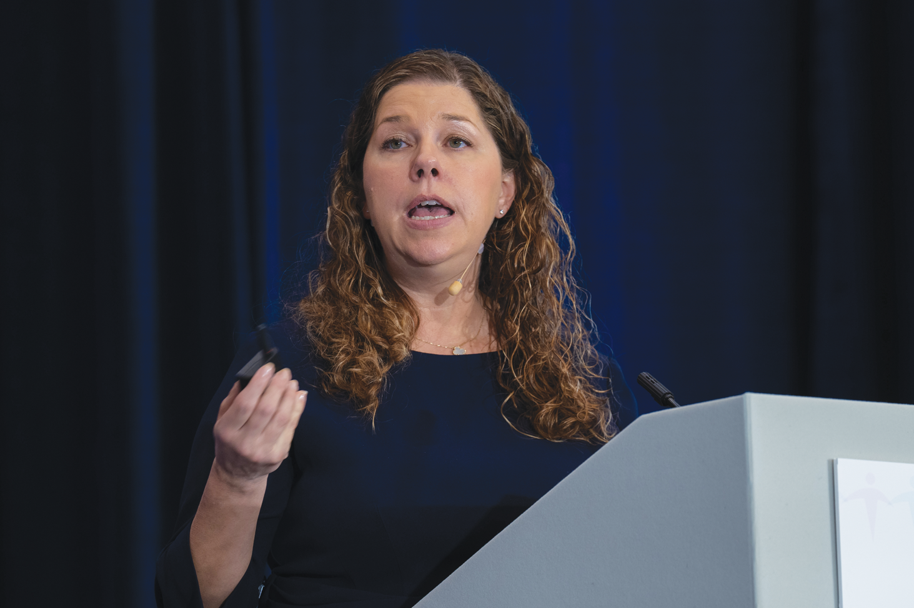
About the Enduring Program
The live meeting is being video
and audio recorded.
The proceedings from today will
be edited and developed into
an enduring web-based program.
An email will be sent to all attendees
when the activity is available.
To learn more about our education programs, visit our website, www.ResearchToPractice.com
Notes:
11
11

Slide 12
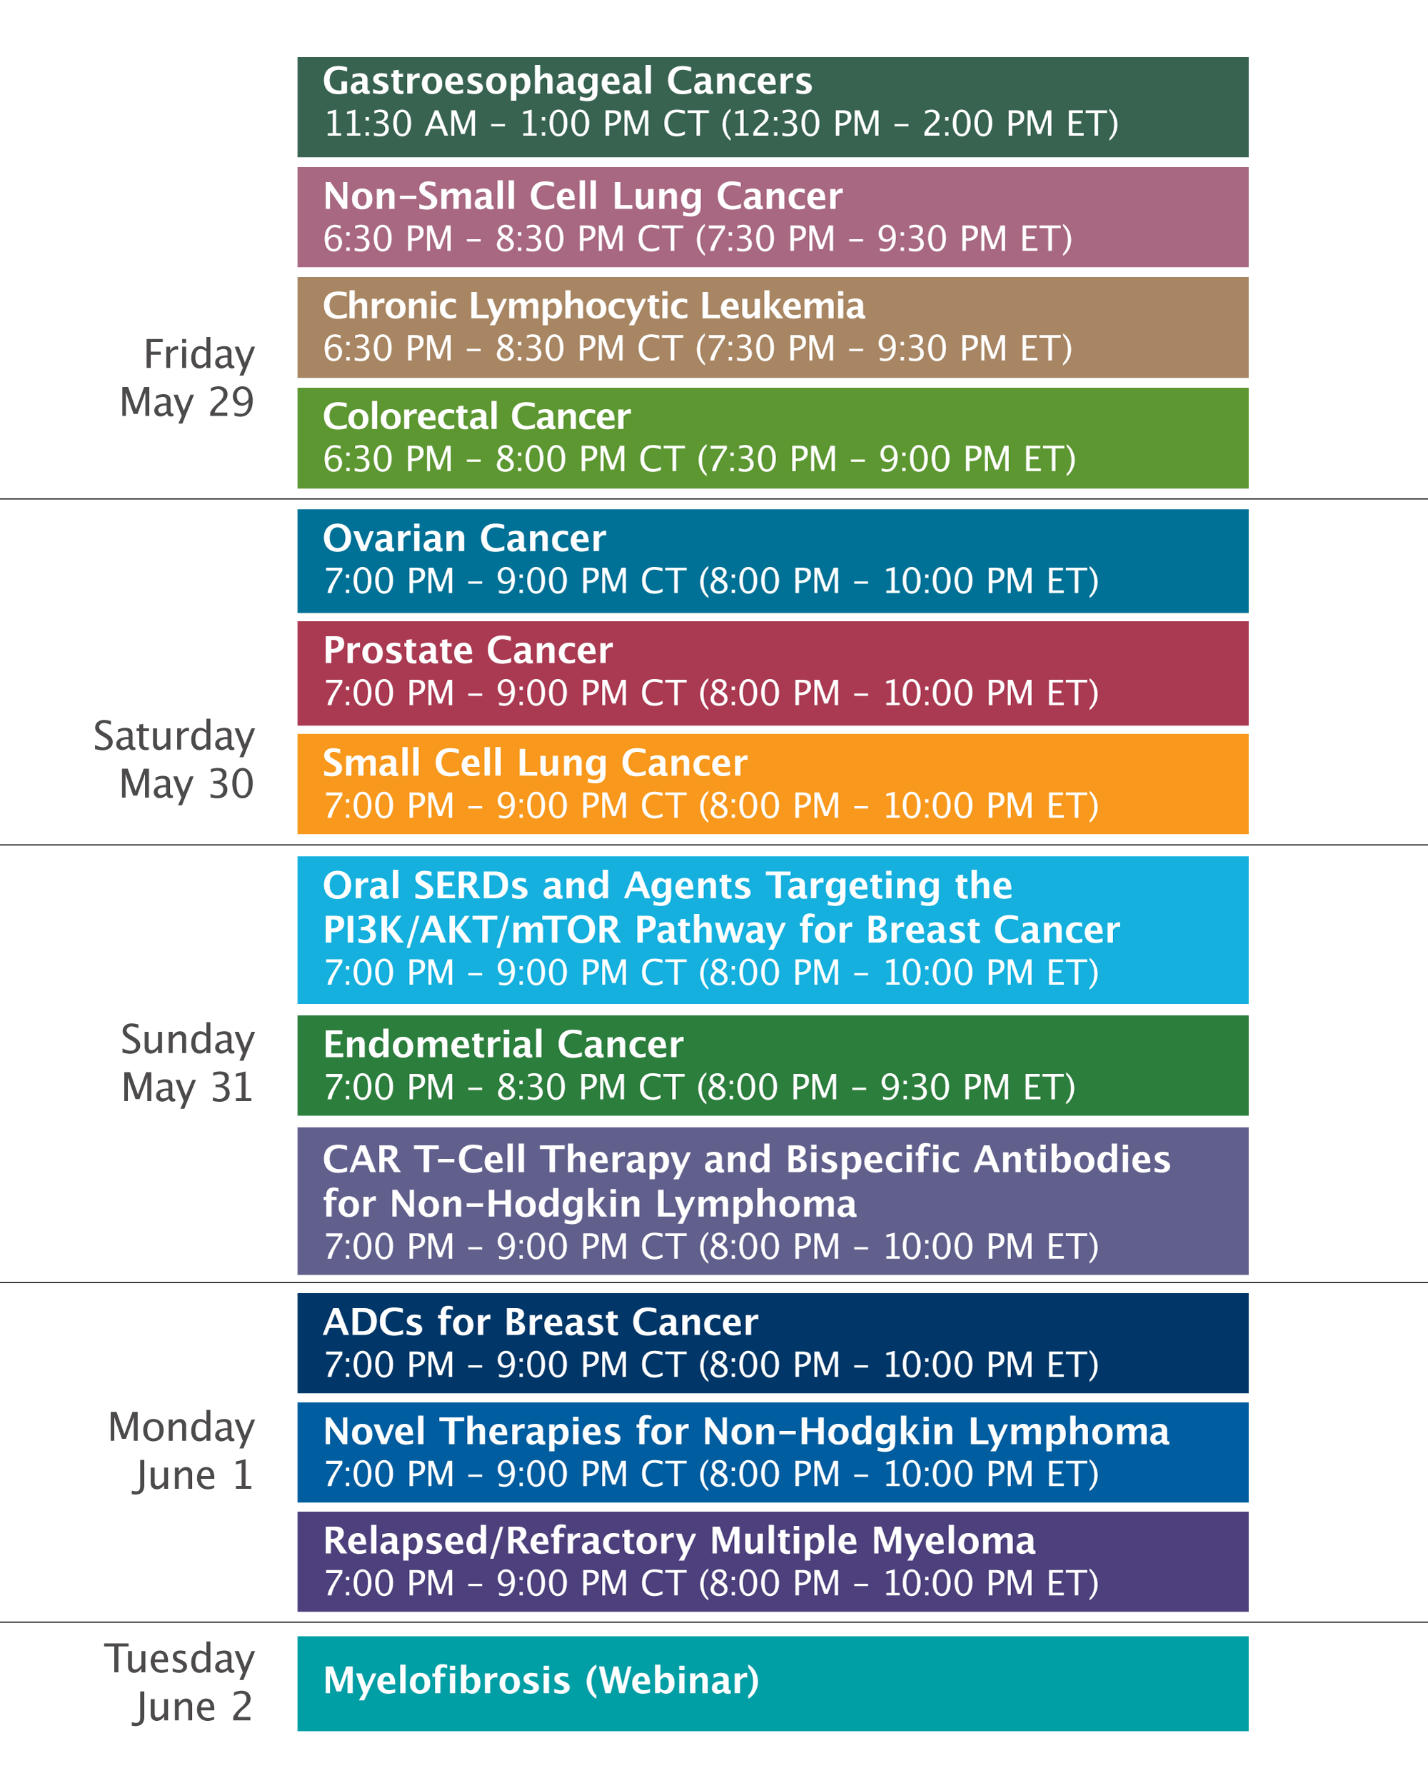

Slide 13
What Clinicians Want to Know: Addressing
Community Oncologists’ Questions About the
Current and Future Management of Endometrial Cancer
Sunday, May 31, 2026
7:00 PM – 8:30 PM CT (8:00 PM – 9:30 PM ET)
Faculty
Floor J Backes, MD
Brian M Slomovitz, MD
Moderator
Shannon N Westin, MD, MPH, FASCO, FACOG

Slide 14
What Clinicians Want to Know:
Addressing Community Oncologists’ Questions
About the Current and Future
Management of Endometrial Cancer
Survey of US-Based General Medical Oncologists and Gynecologic Oncologists
May 13-26, 2026

Slide 15
Agenda
Module 1: Current Up-Front Chemoimmunotherapeutic Approaches for Advanced Endometrial Cancer (EC) — Dr Backes
Module 2: Current and Future Role of Anti-PD-1/PD-L1 Antibodies in Combination with Systemic Therapies Beyond Chemotherapy for Advanced EC — Dr Westin
Module 3: Promising Agents Under Investigation for EC — Dr Slomovitz

Slide 16
Agenda
Module 1: Current Up-Front Chemoimmunotherapeutic Approaches for Advanced Endometrial Cancer (EC) — Dr Backes
Module 2: Current and Future Role of Anti-PD-1/PD-L1 Antibodies in Combination with Systemic Therapies Beyond Chemotherapy for Advanced EC — Dr Westin
Module 3: Promising Agents Under Investigation for EC — Dr Slomovitz

Slide 17

Biology of Advanced Endometrial Cancer
Current Up-Front Chemoimmunotherapeutic Approaches for Advanced Endometrial Cancer (EC)
Floor Backes, MD
Professor
Division of Gynecologic Oncology
The Ohio State University
Columbus, OH, USA
Floor Backes, MD
Professor
Division of Gynecologic Oncology
The Ohio State University
Columbus, OH, USA

Slide 18
Objectives
Discuss endometrial cancer molecular subtypes
Review implications for prognosis and therapeutic decision-making
First-line treatment for advanced or recurrent endometrial cancer
  Potential biomarkers of response to immune checkpoint inhibition
Ongoing first-line studies in dMMR endometrial cancer

Slide 19
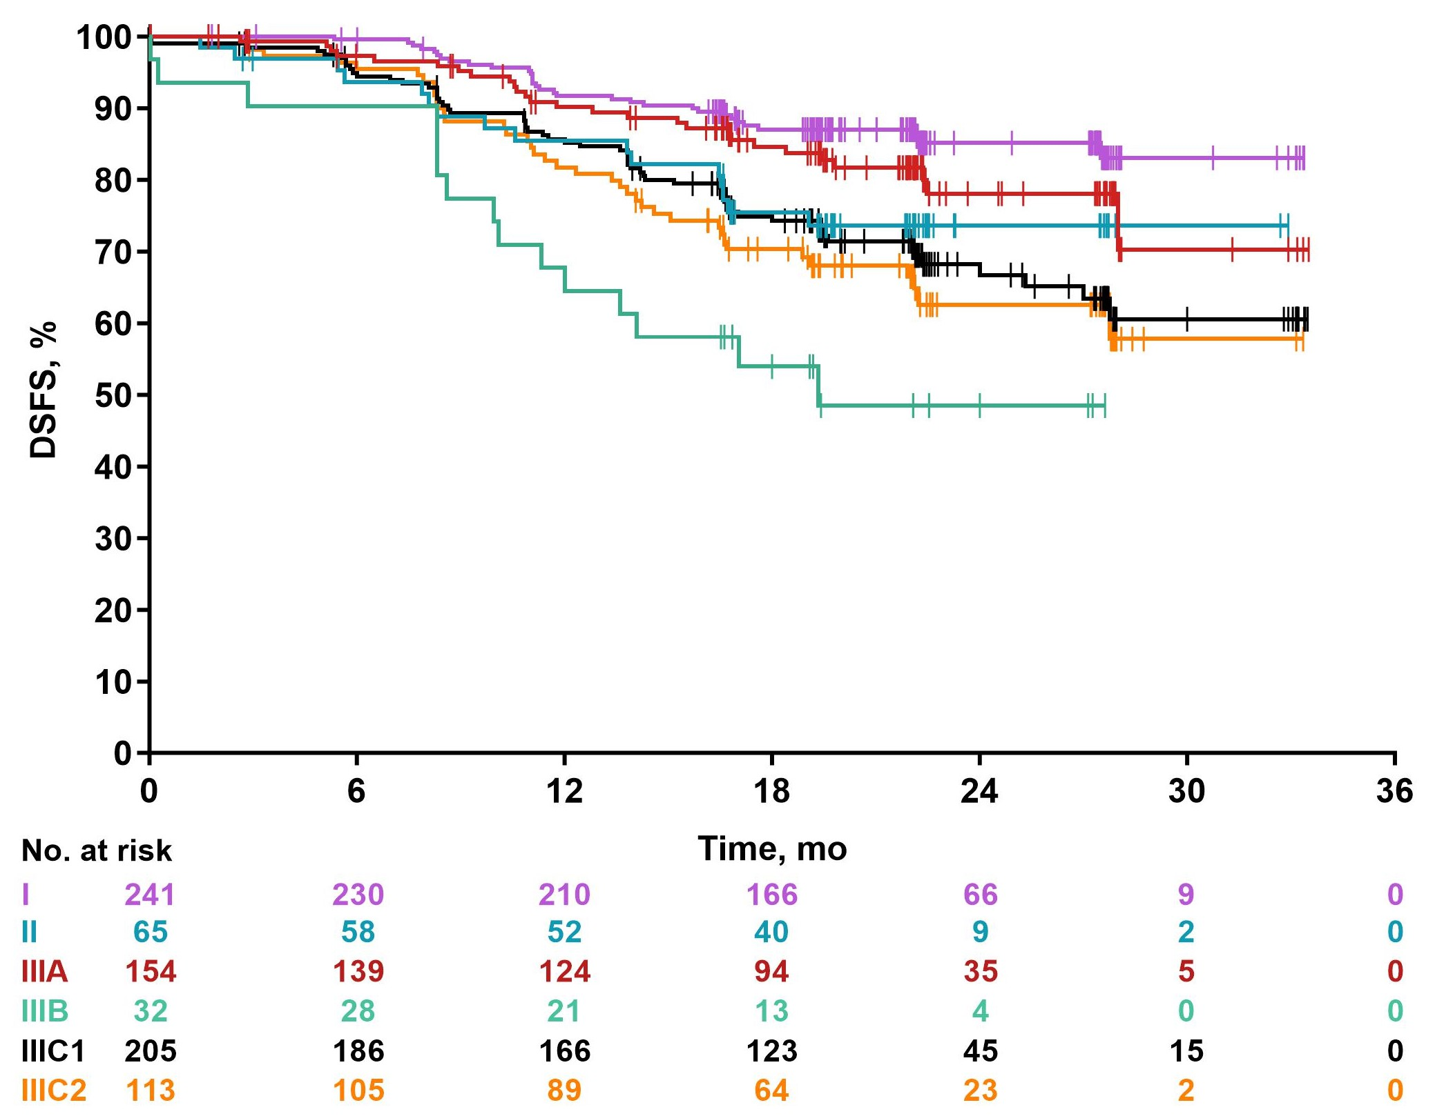
Prognosis by Stage (FIGO 2009) and Histology in pMMR EC (Keynote-B21 Treatment Arms Combined)
Stage
I
II
Endometrioid Carcinoma
Serous Carcinoma
IIIA
IIIC2
IIIC1
IIIB
IIIC1/2
I/II
I/II
IIIA/B
IIIA/B
IIIC1/2
Clear Cell Carcinoma
Carcinosarcoma

Slide 20
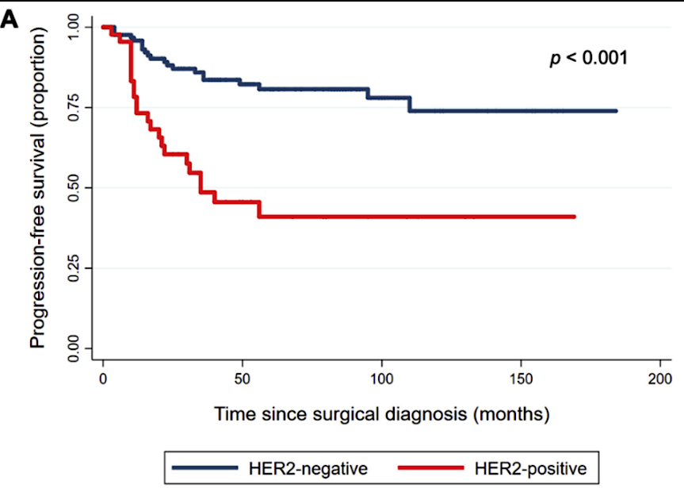
Uterine Serous Carcinoma
10% of all endometrial cancers, but 40% of deaths
75% have TP53 alteration
HER2 overexpression and/or amplification ERBB2
  18-42%
Stage I uterine serous uterine cancer:
  26% were HER2 positive (by IHC and/or FISH).
  Recurrence for HER2 positive 50.0% vs 16.8%, p<0.001 (despite 70% of patients receiving chemotherapy)
HER2 associated with worse PFS and OS
Trastuzumab and Pertuzumab are humanized monoclonal antibodies against HER2
Trastuzumab-Deruxtecan and Trastuzumab-Pamirtecan are HER2 targeting ADCs
Erickson, Gynecol Oncol 2020; Curr Opin Obstet Gynecol 2020

Slide 21
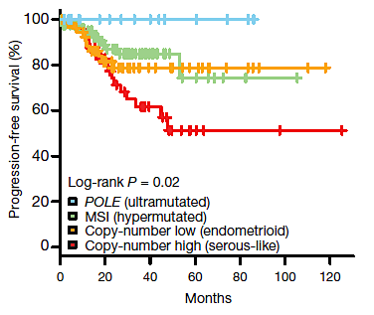
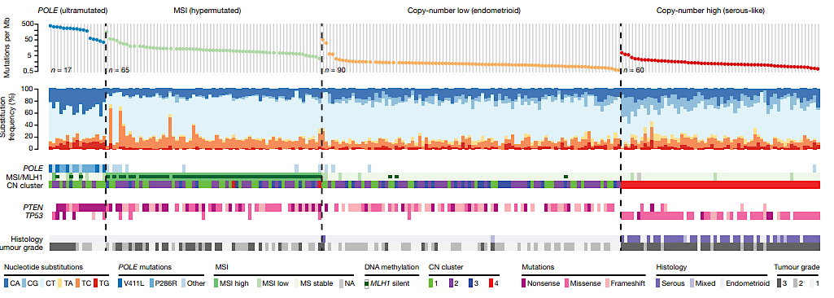
Molecular Profiling
Cancer Genome Atlas Research Network., Kandoth C, Nature 2013

Slide 22
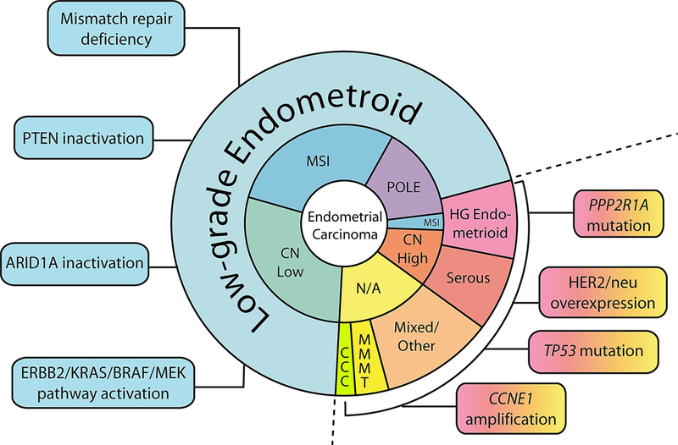
Changing Molecular Landscape
25-35%
Other Factors
p53
PD-L1
HER2 IHC/FISH
TROP2 (>90%)
FRα (64%)
B7H4 (80%)
HRD/HRR (22%)
75-85%
PIK3CA 50-60%
CTNNB1 25%
FGFR 12%
28%
35-40%
20-40%
50-90%
20-30%
42%
Yen TT, et al. Int J Gynecol Pathol. 2020;39(1):26-35.

Slide 23

Molecular subgroups and treatment decision making

Slide 24
PORTEC-3: TCGA Subgroups
TCGA group | n | Treatment | 5-yr RFS | HR (95% CI) | 5-year OS | HR (95% CI)
p53abn | 93 (23%) | EBRT versus CisRT + chemo | 36.2% 58.6% | 1 0.52 (0.30-0.91) | 41.8% 64.9% | 1 0.55 (0.30-1.00)
POLEmut | 51 (12%) | EBRT versus CisRT + chemo | 96.6% 100% | 1 0.02 (<0.01->10⁵) | 96.6% 100% | 1 0.02 (<0.01->10⁵)
MMRd | 137 (33%) | EBRT versus CisRT + chemo | 75.5% 68% | 1 1.29 (0.68-2.45) | 84% 78.6% | 1 1.33 (0.64-2.75)
NSMP | 129 (32%) | EBRT versus CisRT + chemo | 67.7% 79.7% | 1 0.68 (0.36-1.3) | 87.6% 89.3% | 1 0.68 (0.26-1.77)
TCGA = The Cancer Genome Atlas; NSMP = no specific molecular profile; EBRT = external beam radiation; CisRT = cisplatin/radiotherapy.
Leon-Castillo, 2020.

Slide 25
Hyper-mutated/Microsatellite Instable Group:
Responses to IO in the 2nd Line Setting as compared to MSS/MMRp
 | Keynote-158¹ | GARNET² | KEYNOTE-028³ | NCT01375842³ | GARNET²
Phase / type | 2 | 2 | 1b | 1a | 2
Population | Previously treated MSI-H | Previously treated MSI-H/dMMR | Previously treated PD-L1+ MSS/pMMR | Recurrent EC MSS/pMMR | Recurrent MSS/pMMR
Patients, n | 90 | 108 | 24 | 15 | 156
Treatment | Pembrolizumab | Dostarlimab | Pembrolizumab | Atezolizumab | Dostarlimab
Prior lines | 0 - >5 | 1-3 |  |  | 1-3
ORR, % | 48%* | 43.5% | 13% | 13 | 14.1%
DCR, % | 66% | 56% | 26% | 27% | 35%
DOR | NR (3-50+) | NR | — | — | NR
mPFS | 13.1 mo | Immature | 1.8 mo | 1.7 mo
mOS | 12-mo OS= 69% | NR | NR | 9.6 mo
Safety summary (TRAE grade ≥3) | 12% | 13% | 16.7% | Any TRAE: 47% | 19%
1. O’Malley D et al. JCO 2022 ; *in efficacy population n=79 (patients who received 1 or more doses of pembro and were enrolled >26 weeks before data cut off. 2.. Oaknin A et al. J Immunother 2022; 3. Ott PA et al. J Clin Oncol. 2017;35(22):2535-2341; 4. Fleming GF et al. 2017 ASCO Annual Meeting. Abstract 5585;

Slide 26
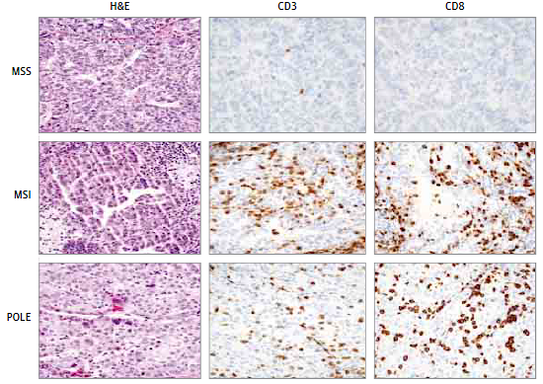
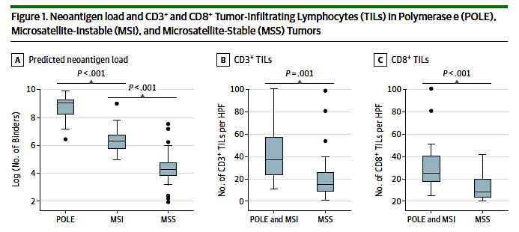





Tumor Microenvironment in Endometrial Cancer
CD = cluster of differentiation; PD-1 = programmed cell death protein 1; TILs = tumor-infiltrating lymphocytes; MSS = microsatellite stable.
Howitt et al, 2015.
Both POLE and MSI are associated with significantly increased predicted neoepitopes and numbers of CD3-positive and CD8-positive TILs compared with MSS tumors
In addition, hypermutated tumors harbor higher neoantigen loads and are associated with increased tumor infiltration by cytotoxic T lymphocytes
POLE and MSI tumors are excellent candidates for immunotherapies targeting the PD-1 pathway

Slide 27
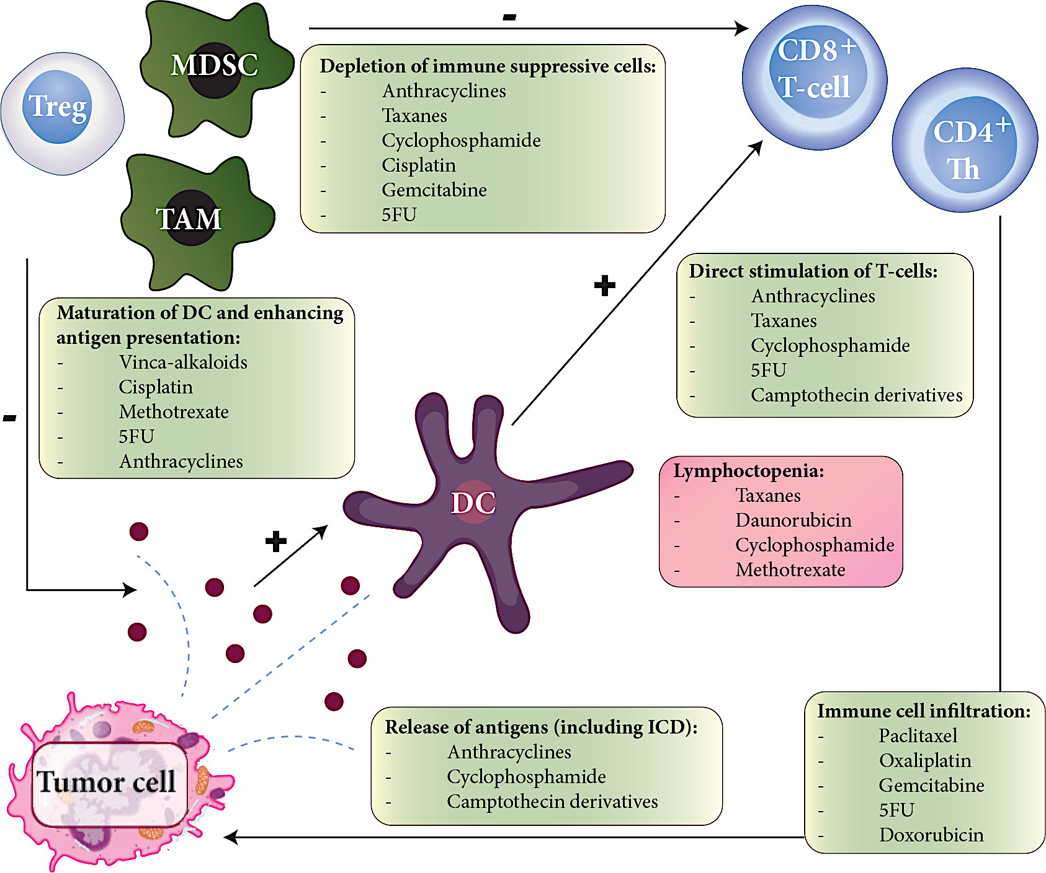
Rationale for Combining Chemo and IO
↓ Myeloid-derived suppressor cells
↑ Antigen cross-presentation after immunogenic cell death
↑ Dendritic cell activity through STAT6 pathway inhibition
↑ Ratio of cytotoxic lymphocytes to regulatory T cells.
↑ Antigenic diversity in tumors by causing DNA damage and releasing tumor-associated antigens
Heinhuis, Ann Oncol 2019

Slide 28
Summary of Study Designs across Key Chemo/IO Trials
 | GY018/KN-868 Pembrolizumab | RUBY-I Dostarlimab | RUBY-II Dostarlimab + Niraparib | DUO-E Durvalumab ± Olaparib | AtTEnd Atezolizumab
Patient Population | Stage III/IVA, measurable, or (non)measurable stage IVB or recurrent EC No prior chemo except if completed ≥12 mo before study | Stage III, IV or recurrent Stage IIIA–IIIC1: Evaluable or measurable disease Stage IIIC2–IV: Measurable or nonmeasurable Adj/neoadj chemo allowed if recurrence ≥6 mo |  | Measurable stage III or (non)measurable stage IV or recurrent endometrial cancer No prior systemic therapy except if adjuvant chemo completed ≥ 12 mo | Newly diagnosed advanced stage (III/IV) endometrial cancer measurable or evaluable Adj/neoadj chemo allowed if recurrence ≥6 mo
Study Design | Pembro + CP → Pembro vs CP | CP + Dost → Dost vs CP | CP + Dost → Dost + Nira vs CP | Durva+ CP → Durva ± Ola vs CP | CP + Atezo → Atezo vs CP
N | 810 | 494 | 291 | 718 | 539
Duration of Maintenance | Up to 2 years | Up to 3 years | Up to 3 years | Until progression | Until progression
Primary Endpoints | PFS (inv. and RECIST) | PFS (inv.) OS | PFS (inv.) OS | PFS (OS analytical secondary end point) | PFS OS
Statistical Design | Separate dMMR & pMMR | dMMR followed by ITT | dMMR followed by ITT | ITT | dMMR followed by ITT
Key Study Locations | US, Canada, Japan, South Korea | US, EU, UK | US, EU, UK | US, EU, Asia, Japan | Australia, EU, UK, Japan

Slide 29
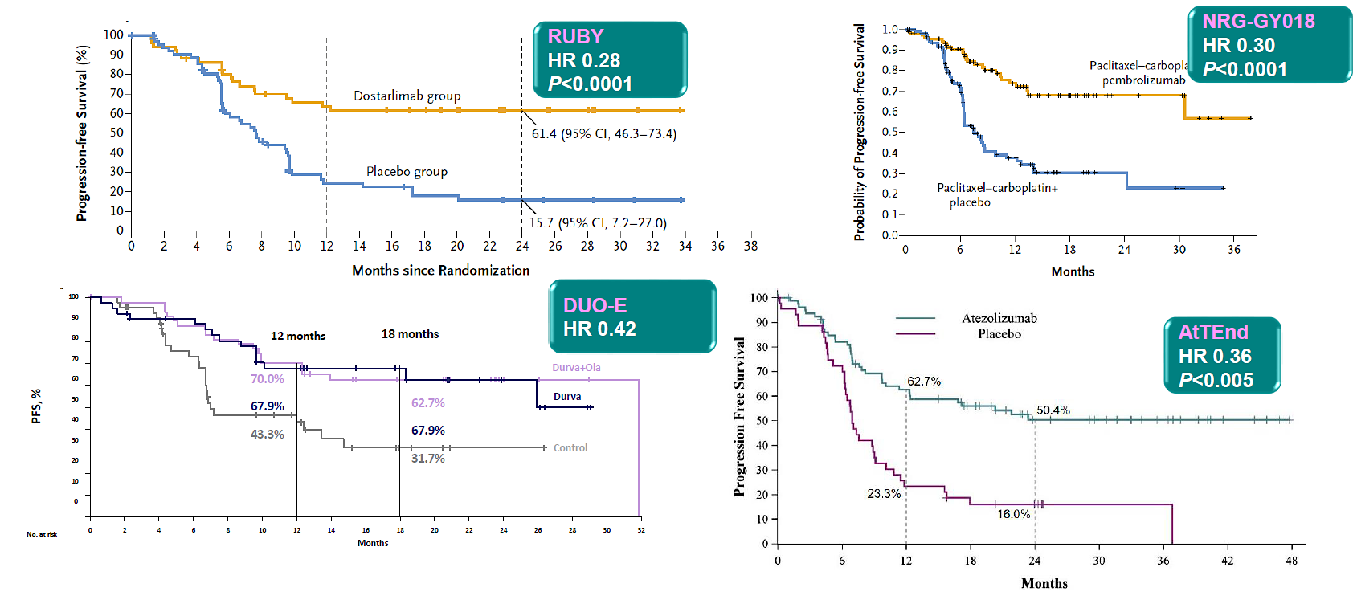
Recurrent dMMR Endometrial Cancer: Carboplatin/paclitaxel + Immunotherapy
4-year PFS 57.9% vs 15.7%

Slide 30
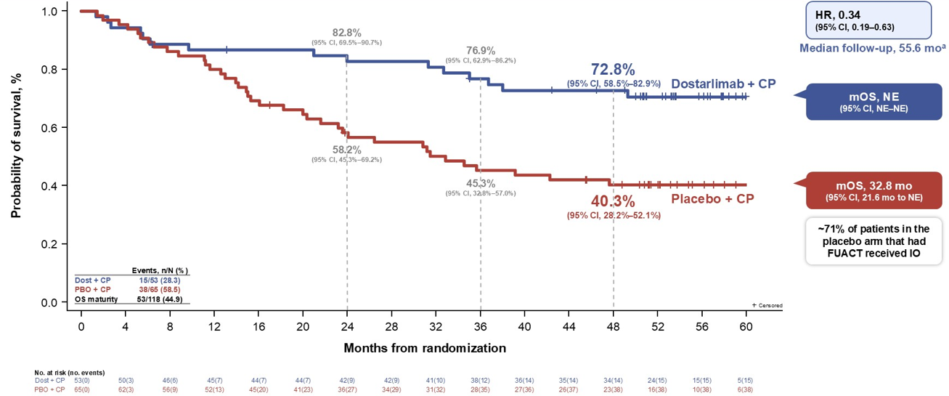
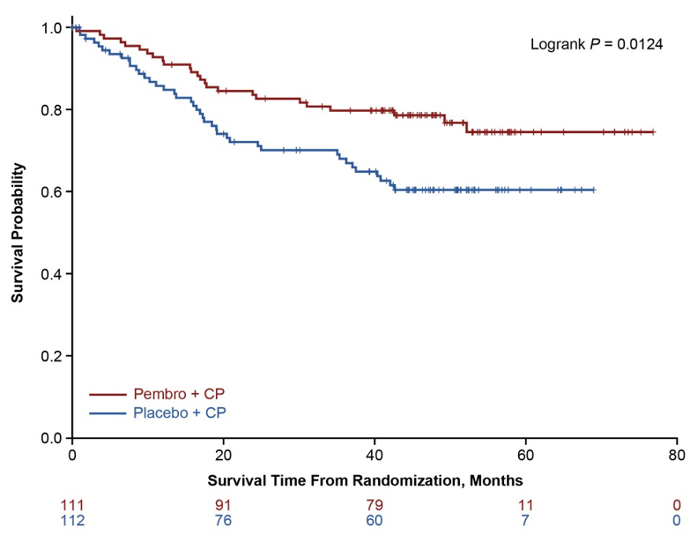

Sustained Overall Survival Benefit at 4 years in dMMR
RUBY
GY018
55% crossover
Median follow up 5 months
55% crossover
Median follow up 49 months
Information fraction 43%
Powell, ASCO 2026; Eskander, ASCO 2026
Notes:
GY018 : 93% of patient in placebo group who received further therapy had IO
RUBY: 71% of patients in placebo group who received further therapy had IO

Slide 31
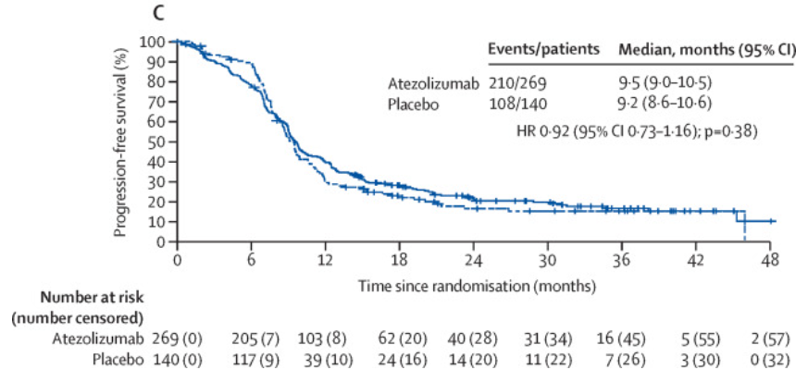
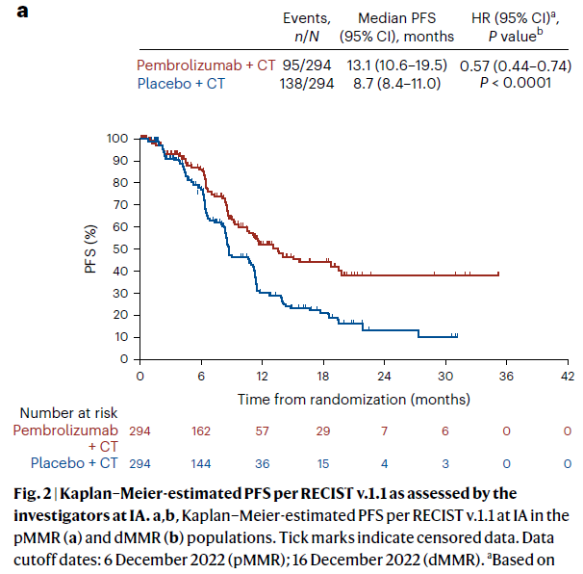
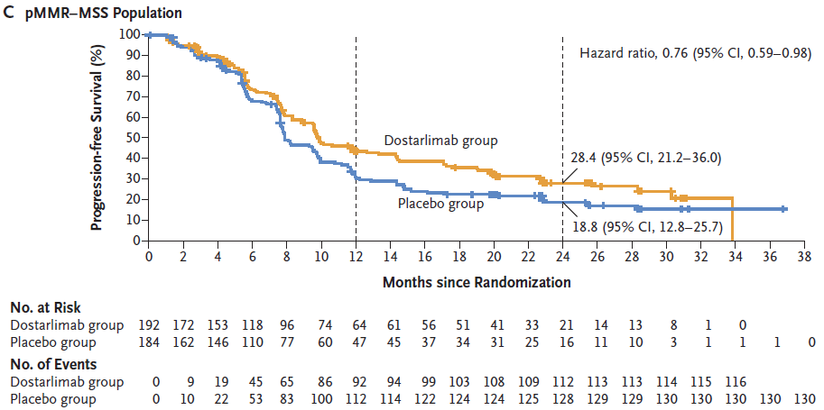
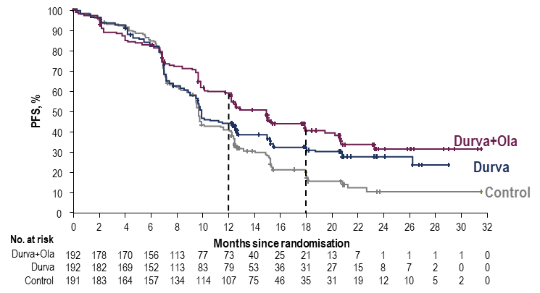
Chemo/IO in pMMR: PFS
AtTEnd
GY018
RUBY
Median PFS (95% CI),* months | 9.7 (9.2–10.1) | 9.9 (9.4–12.5) | 15.0 (12.4–18.0)
HR (95% CI) vs Control† |  | 0.77 (0.60–0.97) | 0.57 (0.44–0.73)
DUO-E
pMMR (80% of population)
DUO-E

Slide 32
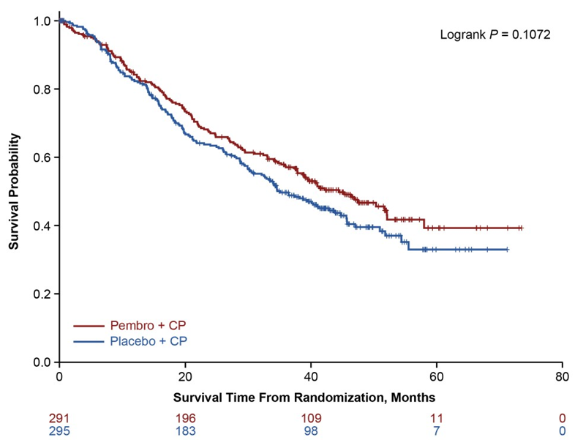
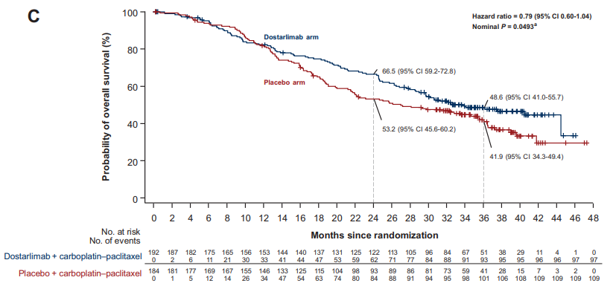
Overall Survival in Recurrent pMMR Endometrial Cancer
RUBY
GY018
Median OS 34.0 vs 27 months
Median OS 44.4 vs 35.1 months (HR 0.84; 95% CI 0.69 to 1.08)
37% crossover
57% crossover
55% information fraction
82% information fraction
Powell, Ann Oncol 2024; Eskander ASCO 2026
Notes:
RUBY had the longest follow up when the data was announced. Despite 60% cross over, the HR for OS was 0.32 in the dMMR population. For Pembro this was 0.55.
A somewhat similar population in LEAP001 had an HR of 0.57 when comparing carbo/taxol to len/pem. This begs the question, do patients with dMMR need chemo at all?
In RUBY: N=118 . 50% of the patients had recurrent disease, 30% stage IV, 20% stage III, 83% endometrioid, 15% prior RT
GY018: in dMMR : prior chemo 5%, prior RT 43%, 90% prior surgery, 84% methylation
GY018: in pMMR: prior chemo 25%, prior RT 41%

Slide 33
Chemotherapy +/- IO: PFS
Study | Chemotherapy + Drug | Hazard ratio dMMR (vs chemo alone) | Hazard ratio pMMR (vs chemo alone)
GY018 | Pembrolizumab | 0.30 | 0.57
RUBY | Dostarlimab | 0.28 | 0.76
AtTEnd | Atezolizumab | 0.36 | 0.92
MITO END-3 | Avelumab | 0.46 | 1.17
DUO-E | Durvalumab +olaparib | 0.42 0.41 | 0.77 0.57
RUBY Part 2 | Dostarlimab +Niraparib | 0.48 | 0.63

Slide 34
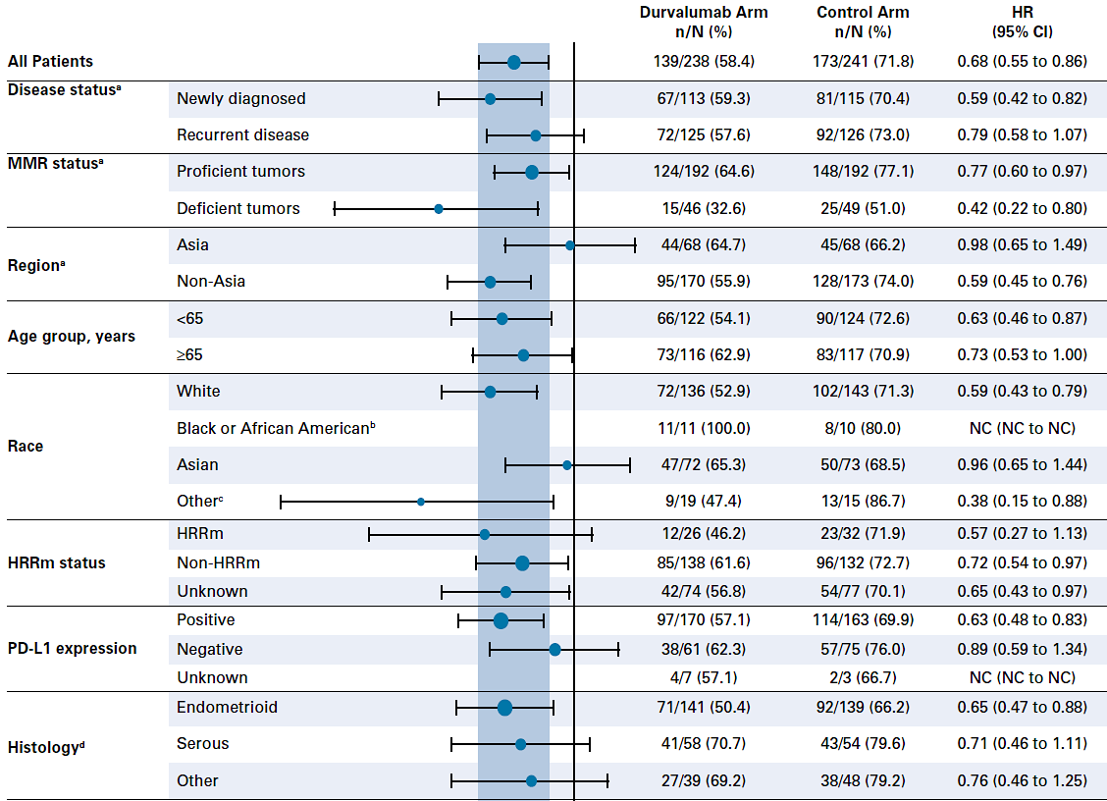
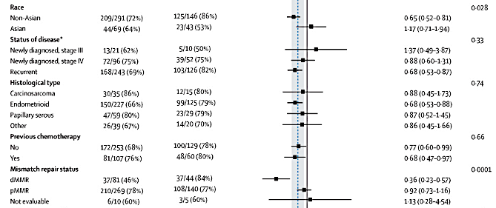
Different responses across trials?
DUO-E
Different populations?
20% Asian in AtTEnd, 28% in DUO-E, 5.3% in GY018, none in RUBY
Subgroup analysis with negative predictive effect of Asian race for IO except for MMRd/MSI-H
Lower clinical efficacy of drugs across populations?
Does gut microbiome play a role?
PD-1 vs PD-L1 inhibitors?
What was the molecular breakdown?
AtTEnd

Slide 35



RUBY Molecular classification algorithm
In RUBY Part 1, molecular classification was performed for all participants with WES results – 400 of 494 patients
EC
(histological subtype independent)
Dr Robert L. Coleman
POLε status
POLε pathogenic
POLε non-pathogenic
MMR status
dMMR
MMRp
p53 status
P53-mut
P53 WT
Integrated diagnosis | POLεmut (EDM) | dMMR (or MSI-H) | TP53 aberrantª | NSMP
Prevalence in RUBY, % (n/N) | 1.25% (5/400) | 22.75% (91/400) | 22% (88/400) | 54% (216/400)
Diagnostic test | WES | Results of local (IHC, NGS, PCR) or central test (IHC) provided for RUBY at randomization | WES | —
Efficacy per molecular classification was an exploratory analysis.
ªp53 mutation status was determined based on WES results. Only pathogenic mutations, identified based on information from ClinVar and cBio databases, were classified as p53mut.
dMMR, mismatch repair deficient; EC, endometrial cancer; EDM, exonuclease domain; IHC, immunohistochemistry; MMRp, mismatch repair proficient; MSI-H, microsatellite instability-high; mut, mutated; NGS, next-generation sequencing; NSMP, no specific molecular profile; PCR, polymerase chain reaction; POLε, polymerase epsilon; TP53, tumor protein 53; WES, whole-exome DNA sequencing; WT, wild type.
R. Coleman, ESMO GYN 2024. Mirza, ESMO 2023

Slide 36

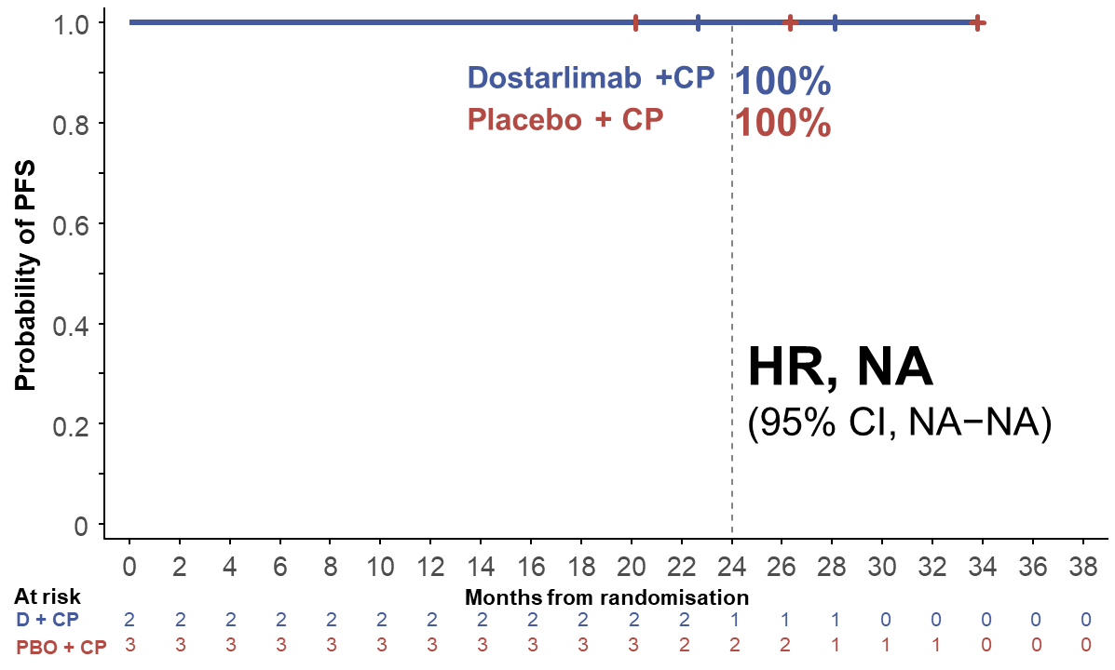
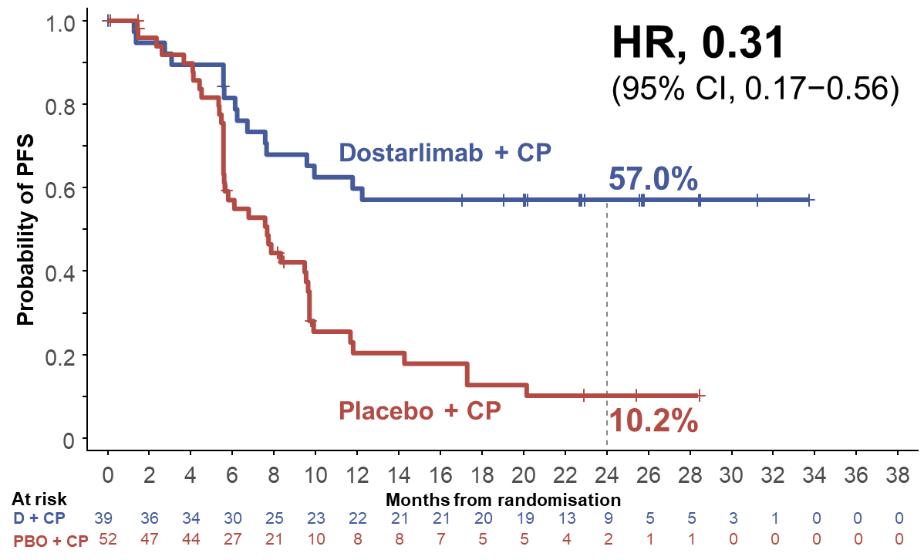
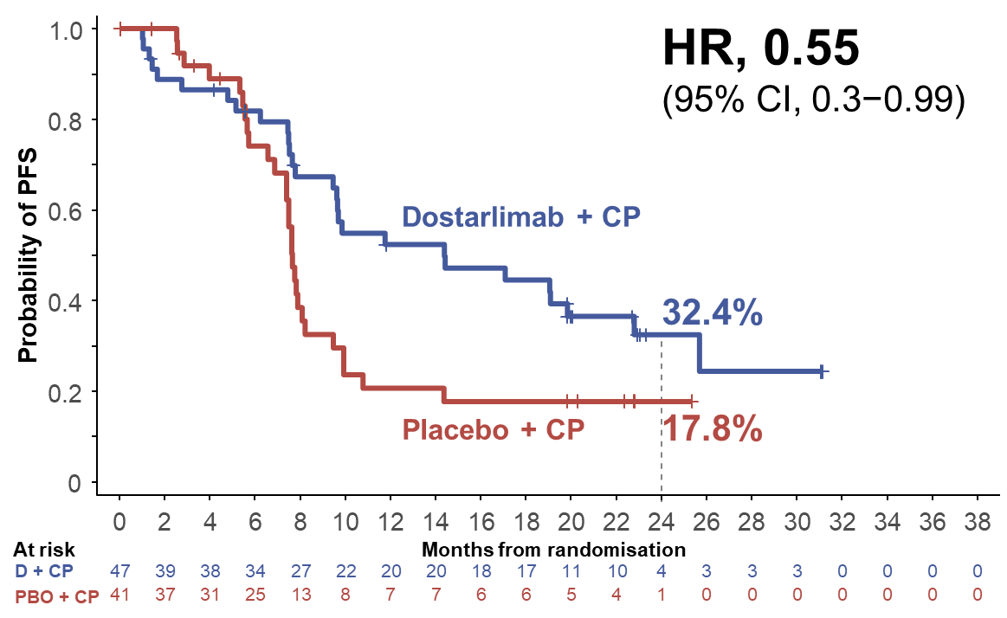
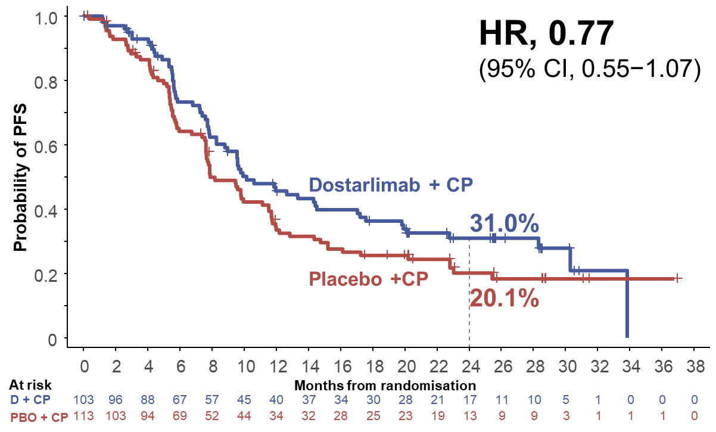
RUBY: PFS According to Molecular Subgroup
POLε mut
dMMR/MSI-H
TP53 mut
NSMP
Dr Mansoor Raza Mirza, ESMO 2023
Data based on exploratory analysis based on 400 patients from the RUBY trial with known molecular classification with whole exome sequencing.
CP, carboplatin-paclitaxel; D, dostarlimab; dMMR, mismatch repair deficient; HR, hazard ratio; MSI-H, microsatellite instability–high; mut, mutated; NR, not reached; NSMP, no specific molecular profile; OS, overall survival; PBO, placebo; POLε , polymerase epsilon; TP53, tumor protein 53.

Slide 37
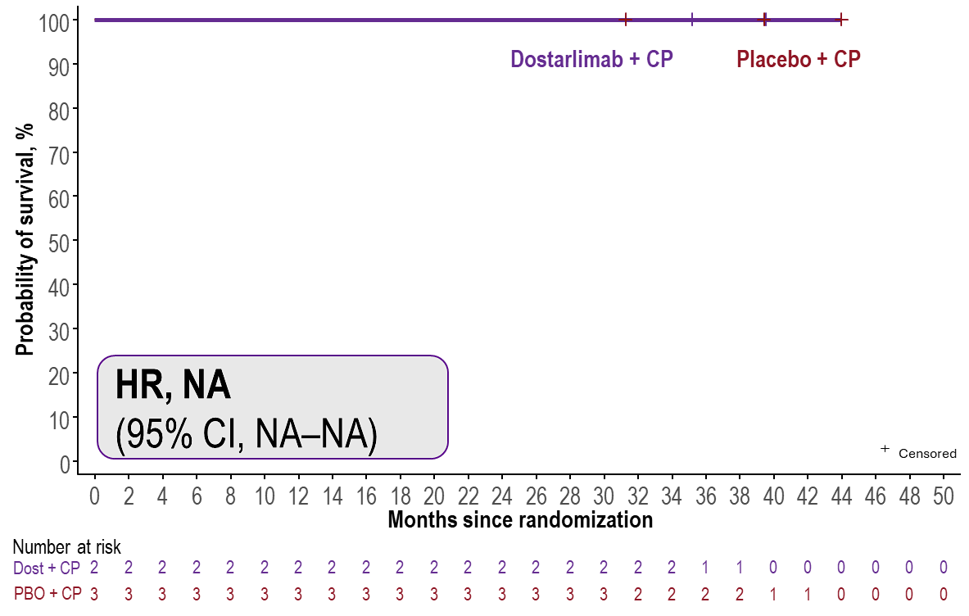
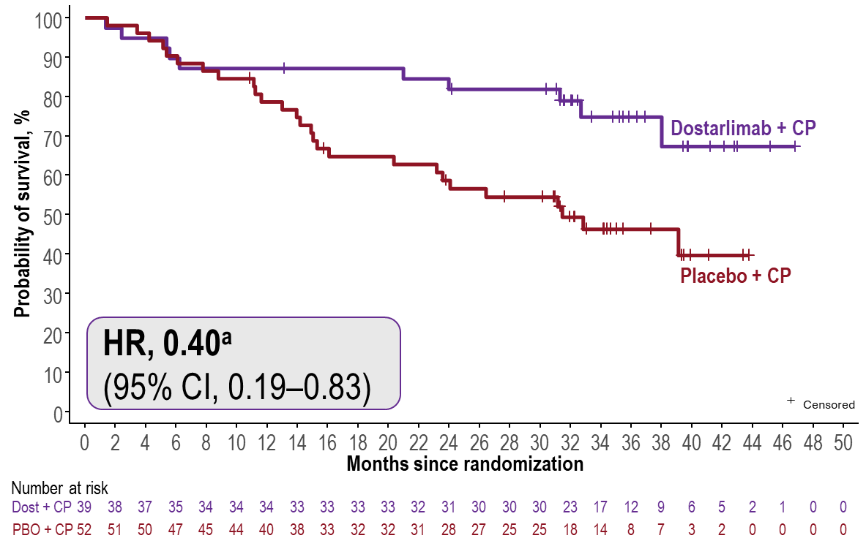
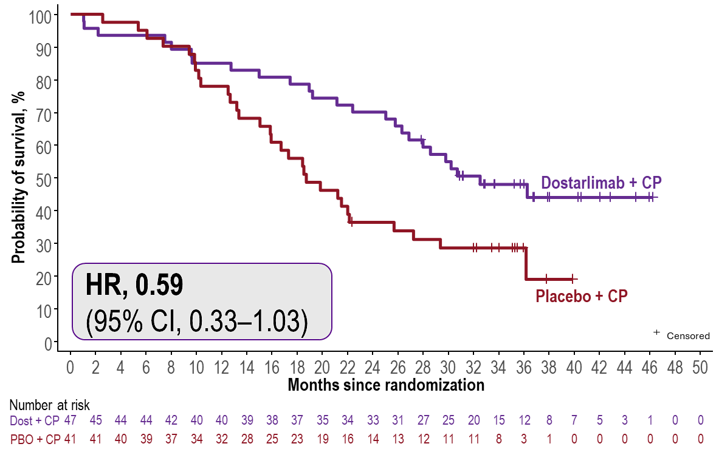
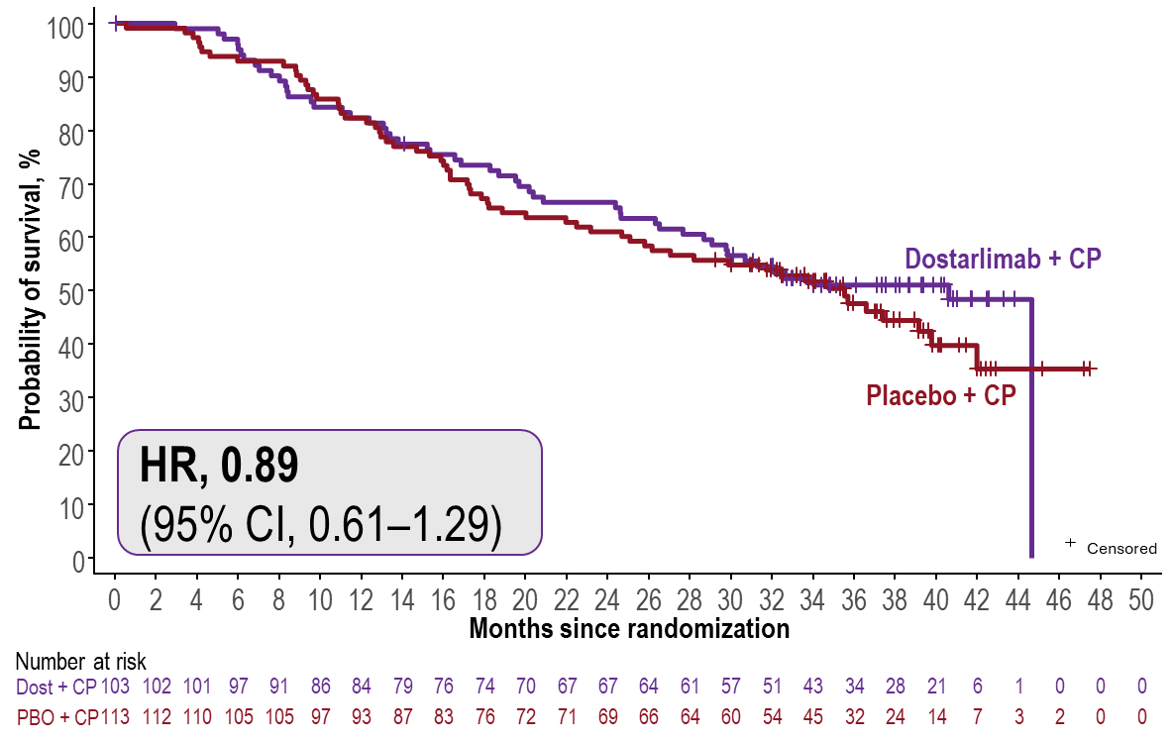
Exploratory analysis of OS per molecular subgroup
Based on 400/494 patients with known molecular classification per WES
POLεmut
dMMR/MSI-H
TP53mut
NSMP
Median expected duration of follow-up in the overall population: 37.2 months (range, 31.0–49.5 months).
ªAnalysis shown on this slide is post hoc exploratory analysis of 91 patients with dMMR/MSI-H EC and WES results. In the prespecified OS analysis of the dMMR/MSI-H population (n=118), shown earlier, HR was 0.32. CP, carboplatin-paclitaxel; Dost, dostarlimab; dMMR, mismatch repair deficient; HR, hazard ratio; MSI-H, microsatellite instability-high; mut, mutated; NA, not applicable; NSMP, no specific molecular profile; OS, overall survival; PBO, placebo; POLε, polymerase epsilon; TP53, tumor protein 53; WES, whole-exome sequencing.
ESMO GYN 2024. R. Coleman

Slide 38
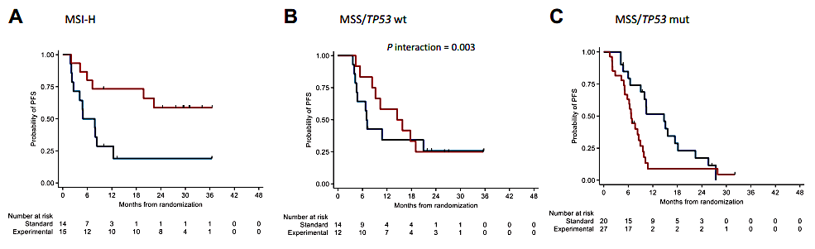




Are all pMMR/MSS/p53mut the same?
MITO END-3 (Avelumab)
TP53 mutation is associated with a poor effect of avelumab, while mutations of PTEN and ARID1A are related to a positive effect of the drug in patients with advanced EC.
RUBY
DUO-E
TP53 mut
Pignata, Ann Oncol 2024; Mirza, ESMO 2023; Westin Gynecol Oncol 2026

Slide 39


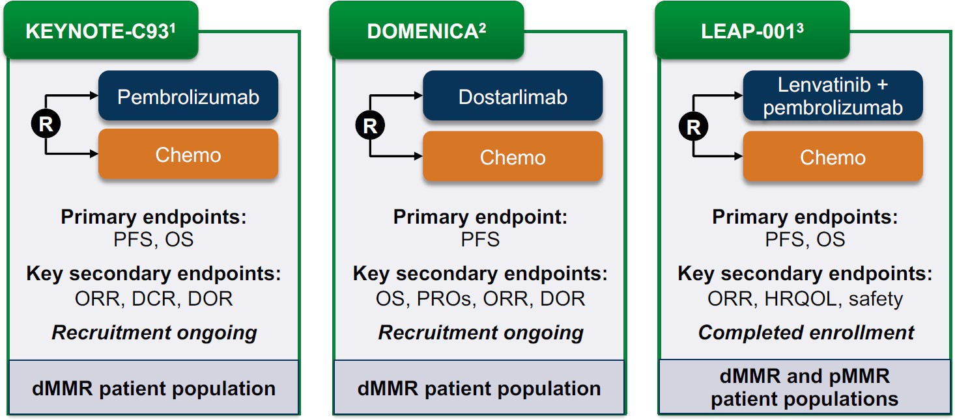

Do patients with dMMR recurrent endometrial cancer need chemotherapy?
ENGOT-en13 DOMENICA
ENGOT-en9 LEAP-001
NCT05173987; NCT05201547; NCT03884101

Slide 40
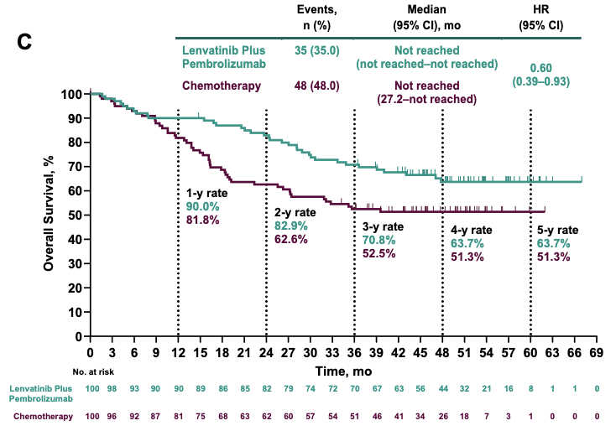
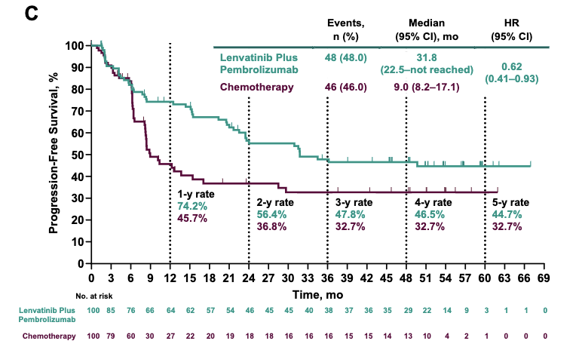
LEAP001: Chemotherapy versus IO combination in dMMR
OS in dMMR population
PFS in dMMR population
Marth, C. Intl J Gynecol Cancer 2026;36(1):102795

Slide 41
Conclusions
Molecular profiling has prognostic and predictive implications
Across most subsets there is a benefit of IO in addition to chemotherapy
Lack of strong predictive biomarker, other than MMR/MSI status
Awaiting results whether first-line chemotherapy remains necessary in dMMR population

Slide 42
Discussion Questions
42-year-old woman with metastatic endometrial cancer, MMR-proficient, started on carboplatin/paclitaxel and dostarlimab with complete radiographic response.
Which biomarker assays do the faculty recommend for newly diagnosed endometrial cancer? Are you generally attempting to determine molecular subtype? If so, what do you do with that information?
How do you decide on first-line treatment? For patients with dMMR EC, how do the experts choose among the approved checkpoint inhibitors in the first line? What about patients with pMMR EC?
How long do you continue IO in the maintenance setting if a patient is in a complete radiographic response?

Slide 43
Discussion Questions
48-yr-old woman w/ pMMR metastatic EC w/ malignant ascites and peritoneal mets.
Carboplatin/paclitaxel/bevacizumab followed by lenalidomide/pembrolizumab upon progression.
For patients with pMMR EC with ascites, would you administer chemo/bevacizumab first line or chemo/IO? Can bev be combined with up-front chemo/IO regimens for patients like this who could clearly benefit?

Slide 44
Discussion Questions
62-year-old woman with recurrent endometrial cancer that is dMMR is started on single-agent pembrolizumab. After 4 cycles, she reports new-onset diarrhea (4-5 loose stools per day), fatigue and a mild rash on her trunk. Her thyroid function tests show an elevated TSH.
How should these likely immune-related adverse events be managed?
What symptoms would prompt immediate withholding of immunotherapy and initiation of corticosteroids?
In which situations, if any, do you save IO for the second line?
Which patients with preexisting autoimmune disease lead you to hold off on first-line IO? What about patients with prior transplants?

Slide 45
Discussion Questions
52 yo patient with de novo MSI-H metastatic endometrial cancer initially treated with carboplatin/paclitaxel/pembrolizumab. Progressive disease 9 months into maintenance pembrolizumab.
Do you have any theories as to why some MSI-H tumors do not respond to IO?
What would you recommend in the second-line setting? Is there any role for ipilimumab/nivolumab?

Slide 46
Discussion Questions
79 yo woman, locally advanced uterine serous carcinoma (3-cm cervical mass with bilateral parametrial involvement, fixed in the pelvis).
p53-mutated, dMMR, PD-L1-negative, HER2-negative.
CAD s/p CABG and stent (2018), PVD s/p bypass x 2 (2024), COPD and CKD.
Treated with neoadjuvant carboplatin, paclitaxel and pembrolizumab with the hope of turning resectable.
In patients with locally advanced endometrial cancer that is initially unresectable, NCCN suggests either neoadjuvant radiation or neoadjuvant chemotherapy. How do you decide which approach to take? Do molecular factors play a role?
If her disease were to recur in the future, what would you consider as first-line therapy given that she has already received pembrolizumab?

Slide 47
Agenda
Module 1: Current Up-Front Chemoimmunotherapeutic Approaches for Advanced Endometrial Cancer (EC) — Dr Backes
Module 2: Current and Future Role of Anti-PD-1/PD-L1 Antibodies in Combination with Systemic Therapies Beyond Chemotherapy for Advanced EC — Dr Westin
Module 3: Promising Agents Under Investigation for EC — Dr Slomovitz

Slide 48
Current and Future Role of Anti-PD-1/PD-L1 Antibodies in Combination with Systemic Therapies Beyond Chemotherapy in Advanced Endometrial Cancer
Shannon N. Westin, MD, MPH
Professor
Medical Director, Gynecologic Oncology Center
Department of Gynecologic Oncology and Reproductive Medicine

Slide 49
PARPi activity across cell lines

Slide 50
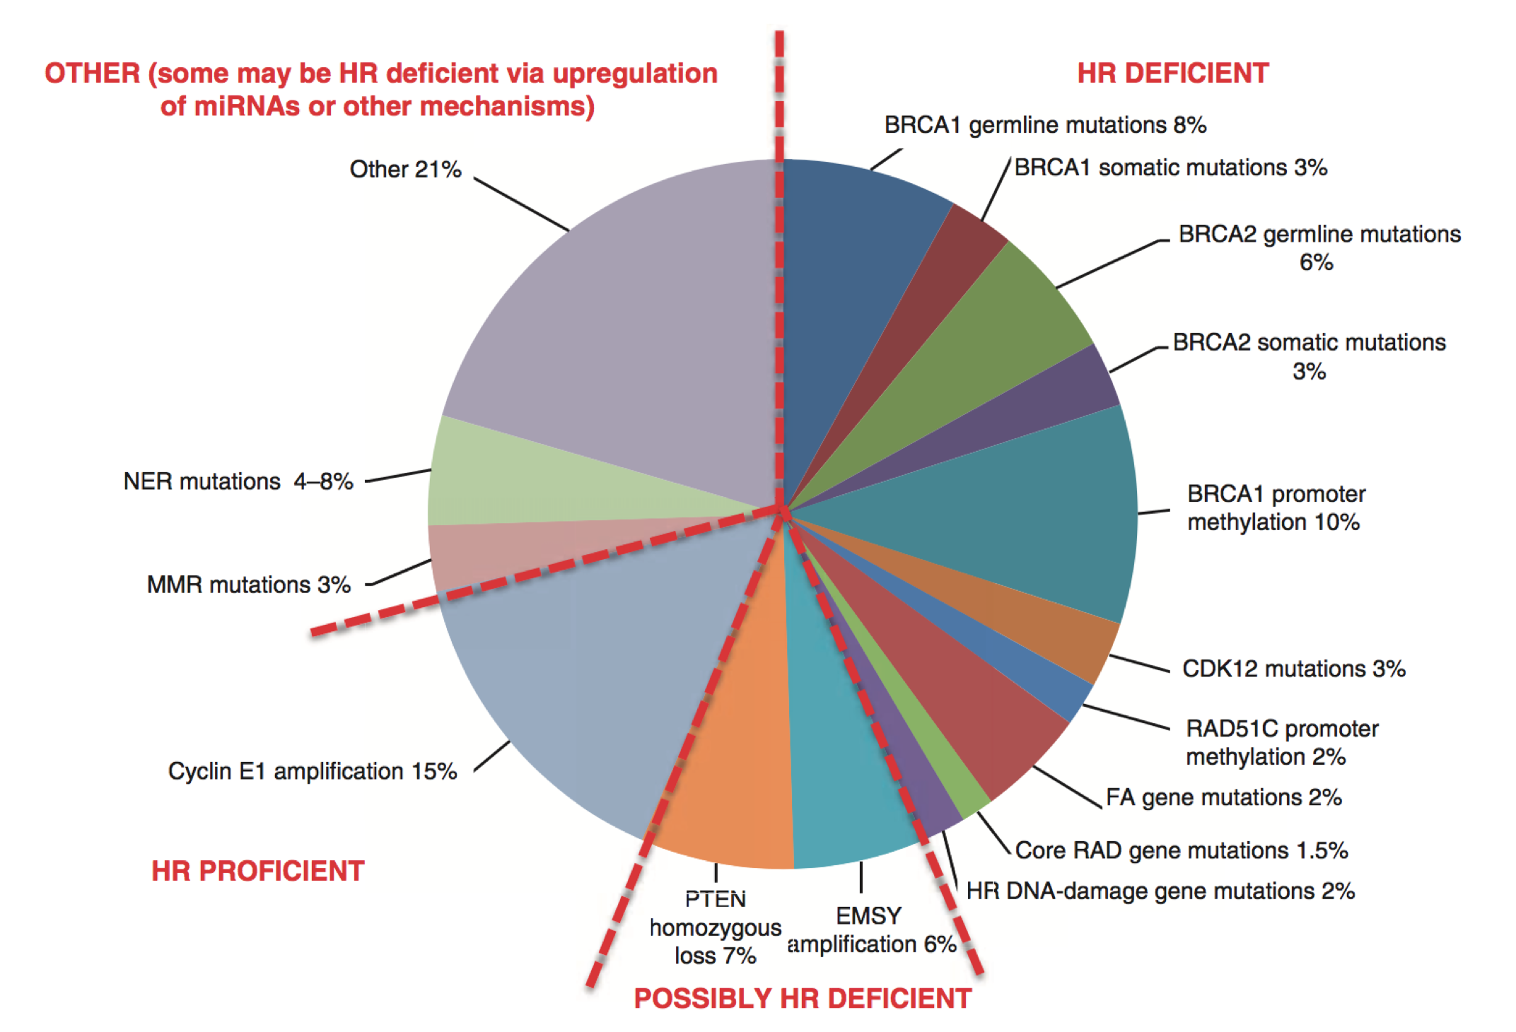
Opportunity for PARP in Endometrial Cancer?
Beyond BRCA - Mechanisms of HRD
Konstantinopoulos Cancer Discovery 2015

Slide 51
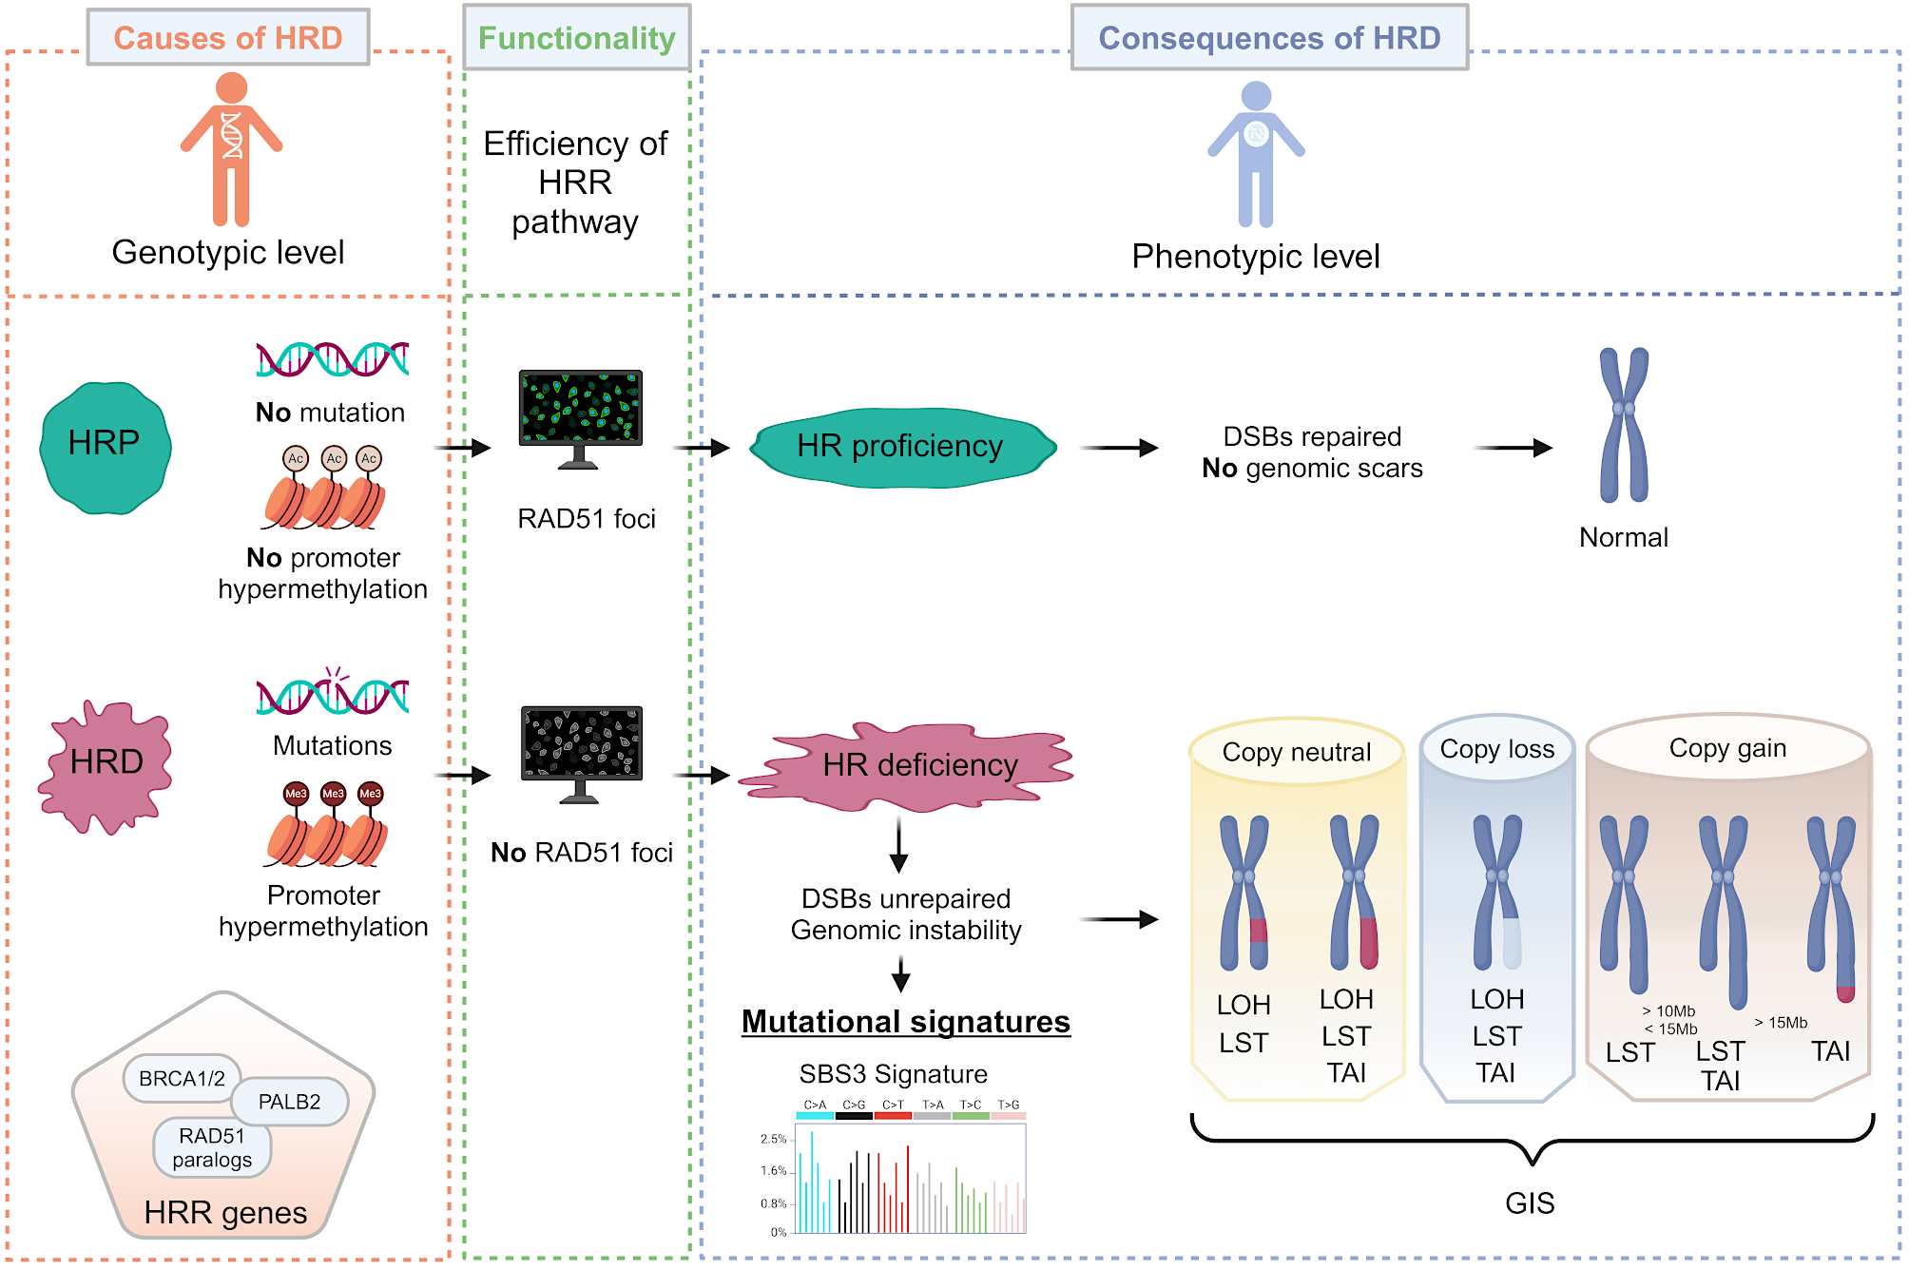
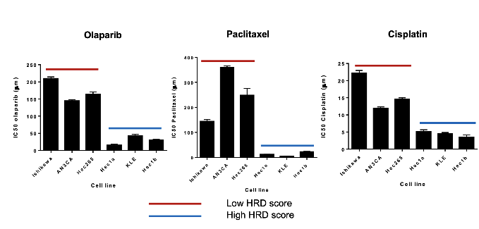
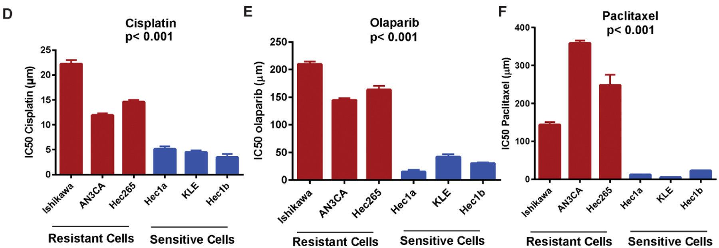
HRD Score in Endometrial Cancer
Witz et al, Biomarker Research, 2025, Siedel, et al. Gynecol Oncol 2021

Slide 52
ARID1A sensitizes to PARPi in EC
Shen Cancer Discov 2015

Slide 53
Homologous Recombination Defects in Endometrial Cancer
Classic HRD members: 22%
ARID1A: 41%
HRD + ARID1A: 48%
HRD, ARID1A, PTEN: 77%
Liang H, et al. Genome Res. 2012.

Slide 54
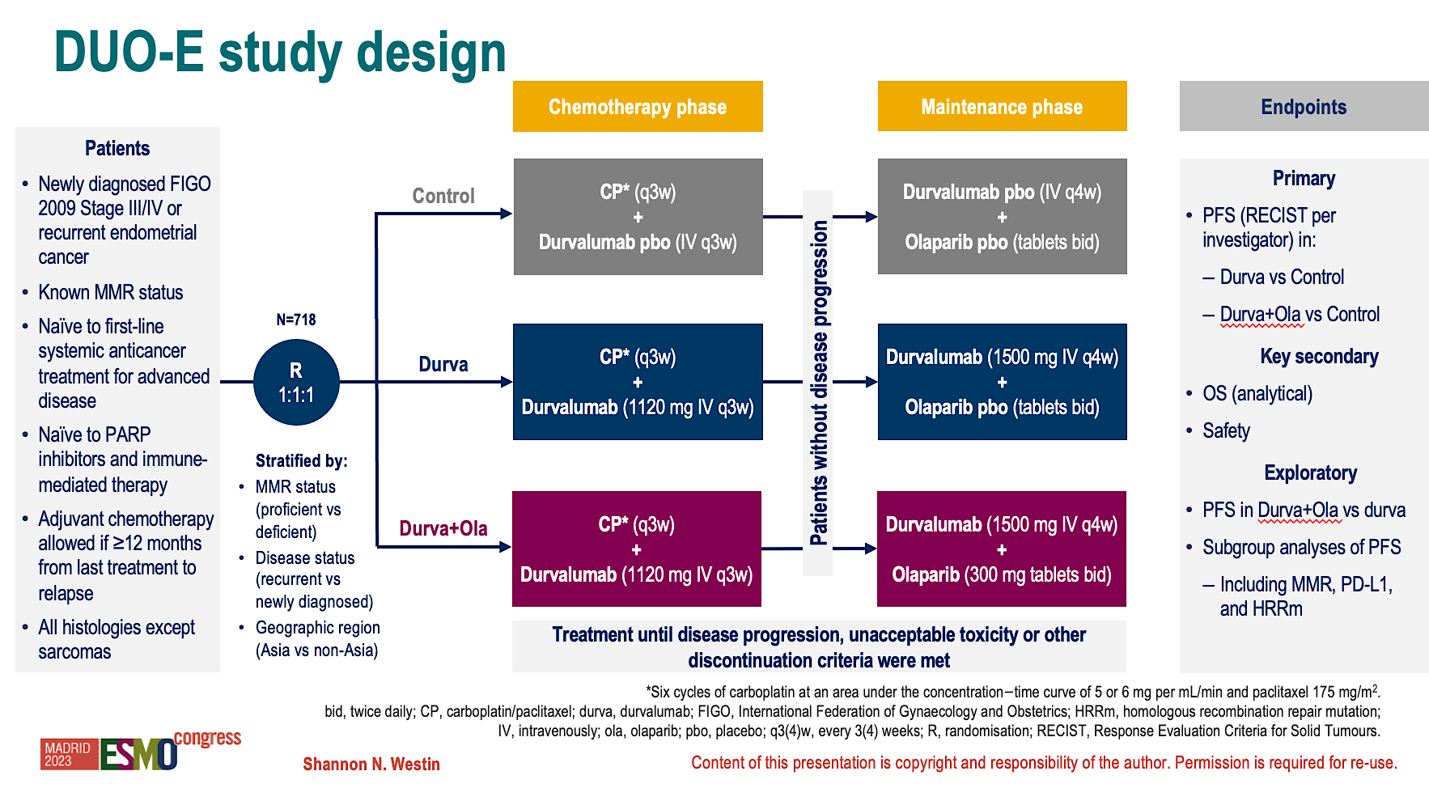
DUO E: Combination of Durvalumab and Olaparib

Slide 55


Addition of Olaparib to Durvalumab Further Enhanced PFS Benefit in pMMR Subpopulation
pMMR endometrial cancer
INDUCTION: CP + durvalumab
MAINTENANCE: durvalumab + olaparib
Olaparib induces DNA damage and further immune priming, which may promote more robust anti-tumour immunity and potentially more durable benefit for the durvalumab + olaparib combination⁹⁻¹¹
CP + durvalumab drives direct tumour killing, which may promote immune priming³⁻⁸
Olaparib
O
O
Olaparib
O
PARP
Biologically heterogeneous population – diverse genomic drivers and variable immune priming²⁻⁴
prespecified exploratory analysis – PFS in pMMR¹
 | CP (n=192) | CP+D (n=192)
Events, n (%) | 148 (77.1) | 124 (64.6)
Median PFS (95% CI),* months | 9.7 (9.2–10.1) | 9.9 (9.4–12.5)
HR (95% CI) vs CP† |  | 0.77 (0.60–0.97)
CP+D+O (n=191)
108 (56.5)
15.0 (12.4–18.0)
0.57 (0.44–0.73)
100
6 months
83.1%
90
82.4%
Immuno-stimulatory, anti-tumour immune cells and signals
84.4%
80
12 months
Immunogenic microenvironment
59.4%
70
44.4%
Immuno-suppressive, pro-tumour immune cells and signals
40.8%
18 months
Overall data maturity, 66.1%
60
42.0%
O
Olaparib
PFS, %
50
31.3%
Chemotherapy
20.0%
Durvalumab
40
T cell/
immune infiltration
30
CP+D+O
20
CP+D
Activated T cell with cytotoxic/anti-tumour activity
10
CP
0
0
2
4
6
8
10
12
14
16
18
20
22
24
26
28
30
32
No. at risk
Time since randomization (months)
*CI for median PFS is derived based on the Brookmeyer–Crowley method; †The HR and CI were estimated from a Cox proportional-hazards model stratified by MMR and disease status.
CP+D+O
191
185
183
168
164
159
157
141
134
132
114
109
107
77
75
72
46
46
35
32
31
20
19
19
12
11
10
5
5
4
2
2
0
CP+D
192
186
182
174
169
159
152
128
113
107
83
81
79
53
53
50
36
36
31
27
27
17
15
15
8
7
7
3
2
2
0
0
0
CP
192
184
178
172
170
163
156
126
113
108
77
76
73
44
40
37
25
25
21
13
13
8
7
6
1
1
1
1
1
1
1
1
0
1. Westin SN, et al. J Clin Oncol. 2024;42:283–99; 2. Rizzo A, et al. J Clin Med. 2022;11:3912; 3. Yang Y, et al. Int J Gynaecol Obstet. 2024;164:436–459; 4. Antill Y, et al. Cancer. 2022;128 1157–1161; 5. Corr B, et al. BMJ Med. 2022;1:e000152; 6. Eskander RN & Powell MA. Ther Adv Med Oncol. 2021;13:1–9; 7. Liu T-Y, et al. Theranostics. 2021;11:5365–5386; 8. El-ghazzi N, et al. Onco Targets Ther. 2023;16:359–369; 9. Stewart RA, et al. Cancer Res. 2018;78:6717–6725; 10. Musacchio L, et al. Cancer Manag Res. 2020;12:6123-6135; 11. Post CCB, et al. Crit Rev Oncol Hematol. 2020;152:102973.
October 2024, Z4-69334

Slide 56
pMMR Subpopulation: PFS by Biomarker Subgroup
CP + Durvalumab + Olaparib vs CP
Post hoc exploratory analysis
CP+D+O
CP
HR (95% CI)
n/N
All pMMR patients |  | 0.57 (0.44–0.73) | 108/191 | 148/192
PD-L1 expression* | Positive (TAP score ≥1%) | 0.44 (0.31–0.61) | 54/112 | 94/124
 | Negative (TAP score <1%) | 0.87 (0.59–1.28) | 52/73 | 53/67
 | Unknown | NC (NC–NC)^{ǁ} | 2/6 | 1/1
POLEm and TP53m status†,‡ | POLEm | NC (NC–NC)^{ǁ} | 1/5 | 0/1
 | TP53m | 0.47 (0.32–0.67) | 52/89 | 73/90
 | TP53 wild-type | 0.71 (0.47–1.07) | 41/72 | 54/71
 | Unknown | 0.74 (0.37–1.45) | 14/25 | 21/30
HRRm status†,§ | HRRm | 0.47 (0.26–0.86) | 22/40 | 22/27
 | Non-HRRm | 0.58 (0.43–0.78) | 72/126 | 105/135
 | Unknown | 0.74 (0.37–1.45) | 14/25 | 21/30
BRCAm status† | BRCAm | NC (NC–NC)^{ǁ} | 7/14 | 11/13
 | Non-BRCAm | 0.57 (0.43–0.75) | 87/152 | 116/149
 | Unknown | 0.74 (0.37–1.45) | 14/25 | 21/30
Histology | Endometrioid | 0.60 (0.42–0.85) | 56/107 | 71/98
 | Serous | 0.46 (0.27–0.76) | 24/42 | 43/52
 | Other¶ | 0.64 (0.38–1.06) | 28/42 | 34/42
0.25
0.5
1
2
Favours CP+D+O
Favours CP
Westin IGCS 2024

Slide 57
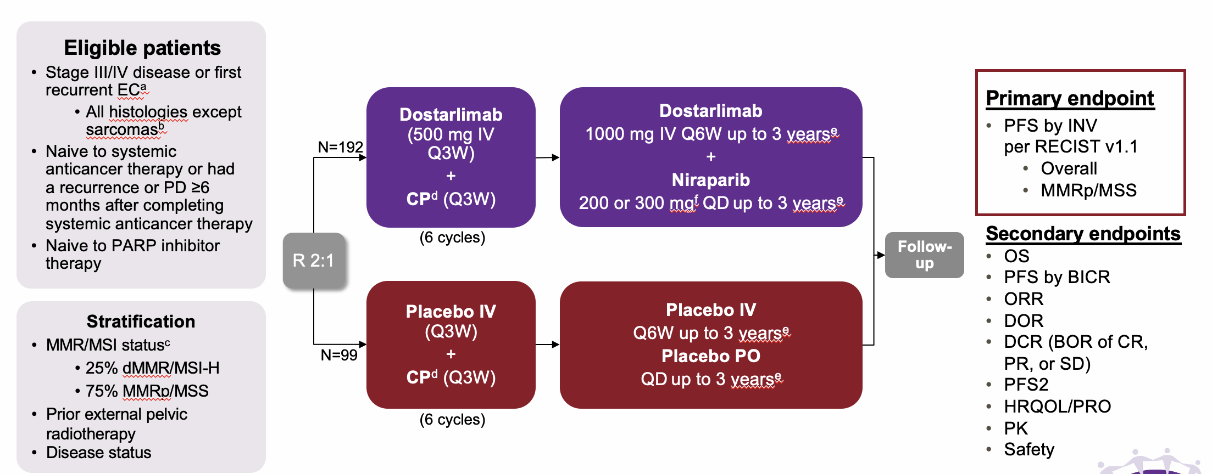
RUBY Part 2 : Dostarlimab + Niraparib in Endometrial Cancer
Mirza. SGO 2024.

Slide 58

Statistically Significant PFS Benefit in MMRp/MSS Population
Primary endpoint
Scan for slides
100
HR, 0.63
(95% CI, 0.44–0.91)
P=0.0060
80
Median duration of
follow-up, 19.1 monthsª
60
54.7%
Probability of PFS, %
40
31.1%
Dostar +
nira + CP
20
 | Median (95%CI), mo | Events, n/N (%)
Dostar + nira + CP | 14.3 (9.7–16.9) | 79/142 (55.6)
Placebo + CP | 8.3 (7.6–9.8) | 53/74 (71.6)
PFS maturity |  | 132/216 (61.1)
Placebo IV +
placebo oral + CP
0
0
2
4
6
8
10
12
14
16
18
20
22
24
26
28
30
No. at risk (events)
Chemotherapy period
Time since randomization, mo
Dostarlimab + niraparib +CP
142(0)
127(5)
119(10)
100(24)
75(42)
67(50)
61(55)
57(58)
47(68)
28(76)
24(76)
11(78)
4(78)
2(79)
1(79)
0(79)
Placebo IV + placebo oral + CP
74(0)
71(1)
65(5)
49(18)
32(33)
22(42)
19(45)
18(45)
13(50)
9(52)
5(52)
4(53)
1(53)
1(53)
0(53)
Mirza. SGO 2024.
ªMedian expected duration of follow-up.
CP, carboplatin-paclitaxel; dostar, dostarlimab; HR, hazard ratio; MMRp, mismatch repair proficient; MSS, microsatellite stable; nira, niraparib; PFS, progression-free survival.

Slide 59
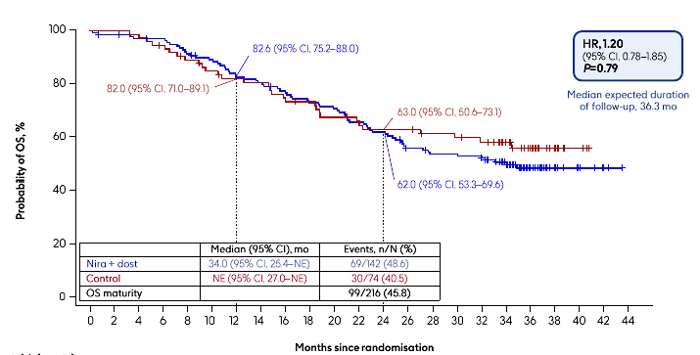
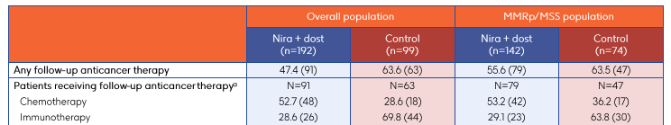
No Overall Survival Benefit in MMRp/MSS Population
Powell, ESGO 2026

Slide 60
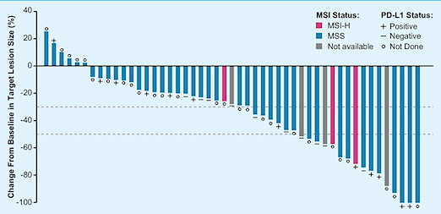
Lenvatinib and Pembrolizumab
KEYNOTE-146: A basket study of lenvatinib + pembrolizumab: Results in patients with advanced platinum resistant ovarian cancer NCT02501096
KEYNOTE-775: Randomized phase II trial of lenvatinib + pembrolizumab vs. MD choice chemotherapy in recurrent endometrial cancer NCT03517449
Arm A
MD Choice:
Paclitaxel Q week
doxorubicin
R
A
N
D
O
M
I
Z
A
T
I
O
N
Arm B
Lenvatinib + Pembrolizumab
ORR 39.6% (21/53, 95% CI 26.5 – 54.0)
MSI-H 50.0% (2/4, 95% CI 6.8 – 93.2)
MSS 35.6% (16/45, 95% CI 21.9 – 51.2)
1:1:1
n = 770
Primary Endpoint: PFS, OS
Makker ASCO 2017, Makker ASCO 2018

Slide 61
At 5 Years, Len + Pembro OS Benefit Continues to be Consistent With the Primary Analysis
pMMR
dMMR
All-Comers
Median (95% CI),ª mo | 18.0 (14.9–20.5) | 12.2 (11.0–14.1)
Events, n (%) | 285 (82.4) | 310 (88.3)
HR (95% CI)^{b} | 0.70 (0.60–0.83)
Median (95% CI),ª mo | 31.9 (15.6–47.7) | 8.6 (5.5–13.4)
Events, n (%) | 40 (61.5) | 53 (81.5)
HR (95% CI)^{b} | 0.44 (0.29–0.67)
Median (95% CI),ª mo | 18.7 (15.6–21.3) | 11.9 (10.6–13.3)
Events, n (%) | 325 (79.1) | 363 (87.3)
HR (95% CI)^{b} | 0.66 (0.57–0.77)
Makker, IGCS 2025

Slide 62
At 5 Years, Len + Pembro PFSª Benefit Continues to be Consistent With the Primary Analysis
pMMR
dMMR
All-Comers
Median (95% CI),^{b} mo | 6.7 (5.6–7.4) | 3.8 (3.6–5.0)
Events, n (%) | 289 (83.5) | 249 (70.9)
HR (95% CI)^{c} | 0.60 (0.51–0.72)
Median (95% CI),^{b} mo | 14.8 (5.6–31.9) | 3.7 (3.1–4.4)
Events, n (%) | 43 (66.2) | 49 (75.4)
HR (95% CI)^{c} | 0.39 (0.25–0.60)
Median (95% CI),^{b} mo | 7.3 (5.7–7.6) | 3.8 (3.6–4.2)
Events, n (%) | 322 (80.8) | 298 (71.6)
HR (95% CI)^{c} | 0.56 (0.48–0.66)
Makker, IGCS 2025

Slide 63
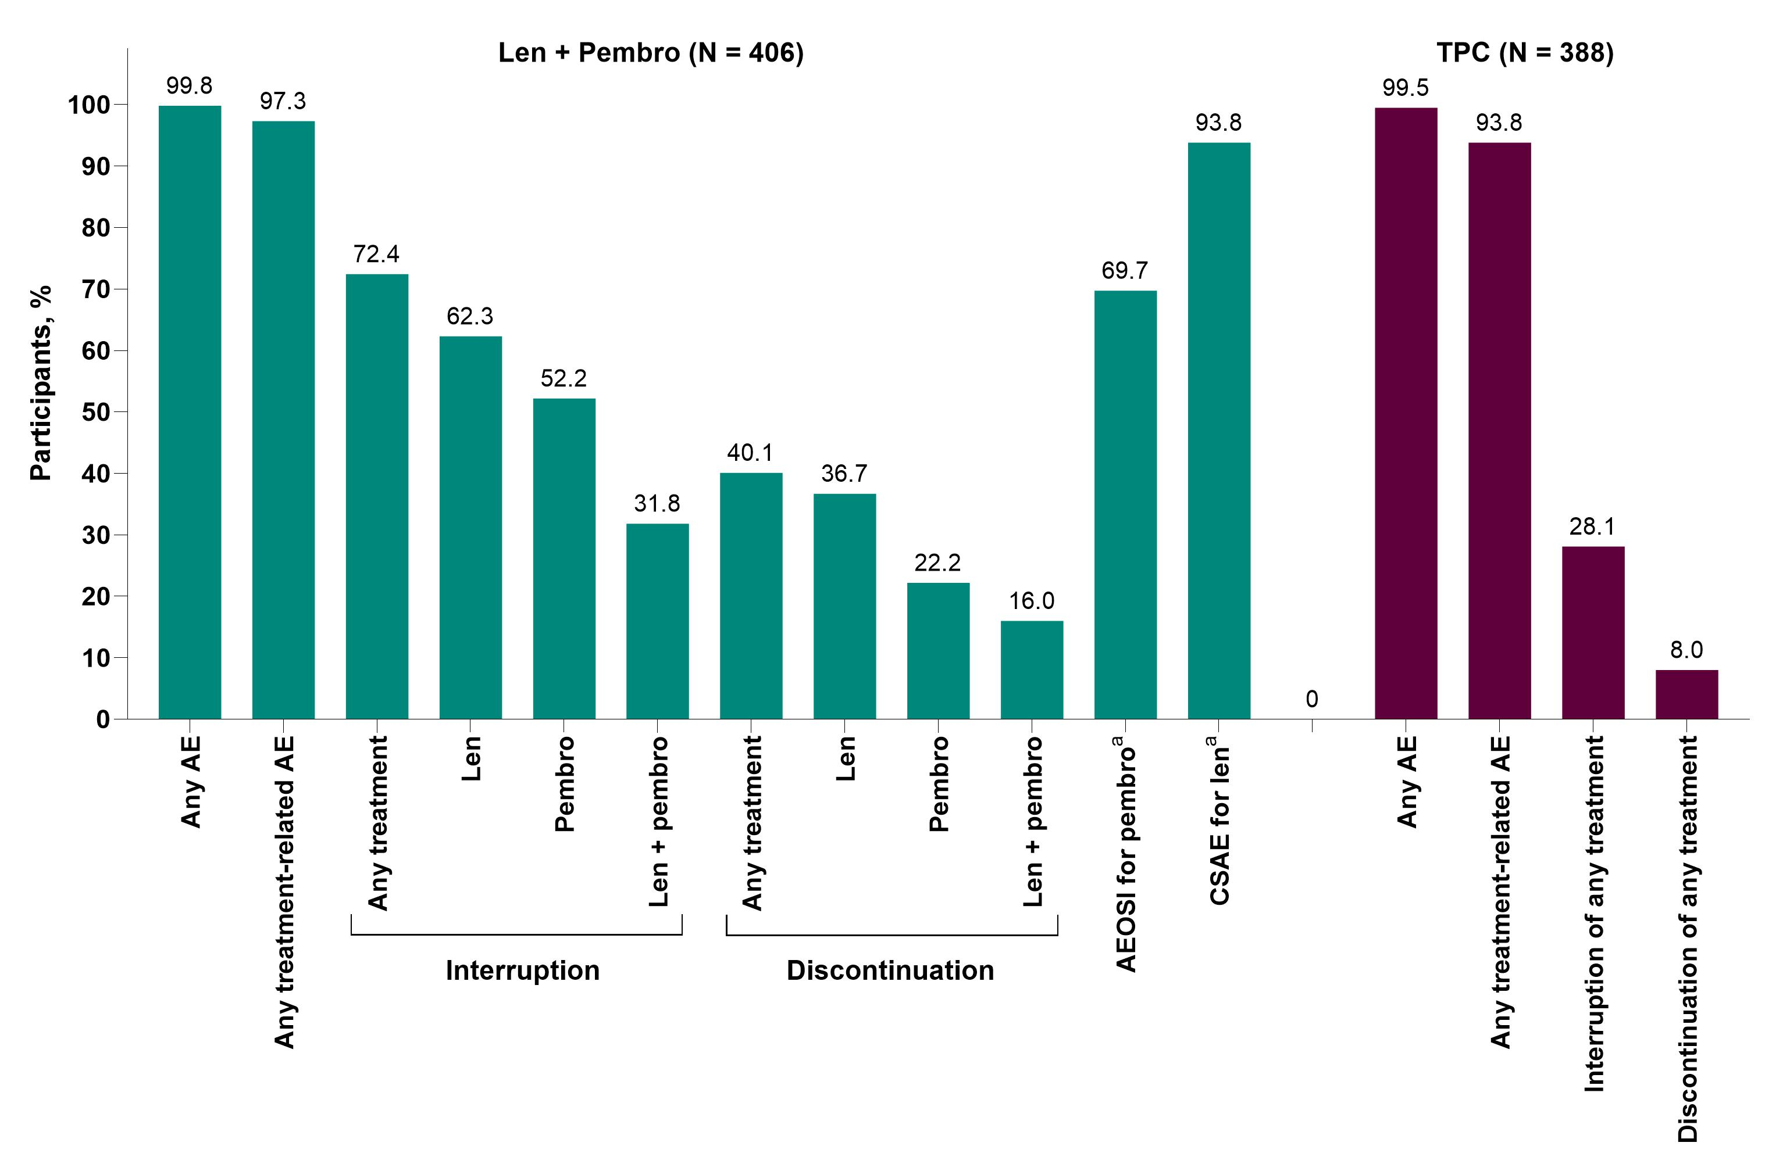
Summary of AEs and Len Dose Reductions
 | Len + Pembro (N = 406)
Len dose intensity, median (range), mg/d | 13.4 (3–20)
Time to first len dose reduction, median (range), mo | 2.0 (0.1–32.5)
Len dose reduction, %
Any | 72.2
1 | 23.4
2 | 24.4
3 | 15.5
4 | 8.9

Slide 64
ENGOT-en9/LEAP-001 Study Design
Key Eligibility Criteria
Stage III, Stage IV or recurrent endometrial carcinomaª
Radiographically apparent disease - either measurable or nonmeasurable
No prior chemotherapy except in the
neo/adjuvant setting^{b}
ECOG PS 0-1
Tumor tissue sample for MMR testing
Lenvatinib 20 mg orally QD until PD
+
Pembrolizumab 200 mg IV Q3W
until PD or x35 cycles
R (1:1)
N = 842
Paclitaxel 175 mg/m² IV
+
Carboplatin AUC 6 IV Q3W
up to 7 cycles^{c}
Stratification Factors
MMR status (pMMR vs dMMR),
If pMMR
  ECOG PS (0 vs 1)
  Measurable disease (yes vs no)
  Prior chemotherapy and/or chemoradiation (yes vs no)
Endpoints
Dual primary: PFS per RECIST v1.1 by BICR and OS
Secondary: ORR per RECIST v1.1 by BICR, safety, and HRQoL
Exploratory: Included DOR per RECIST v1.1 by BICR
Marth ESGO 2024, SGO 2024

Slide 65
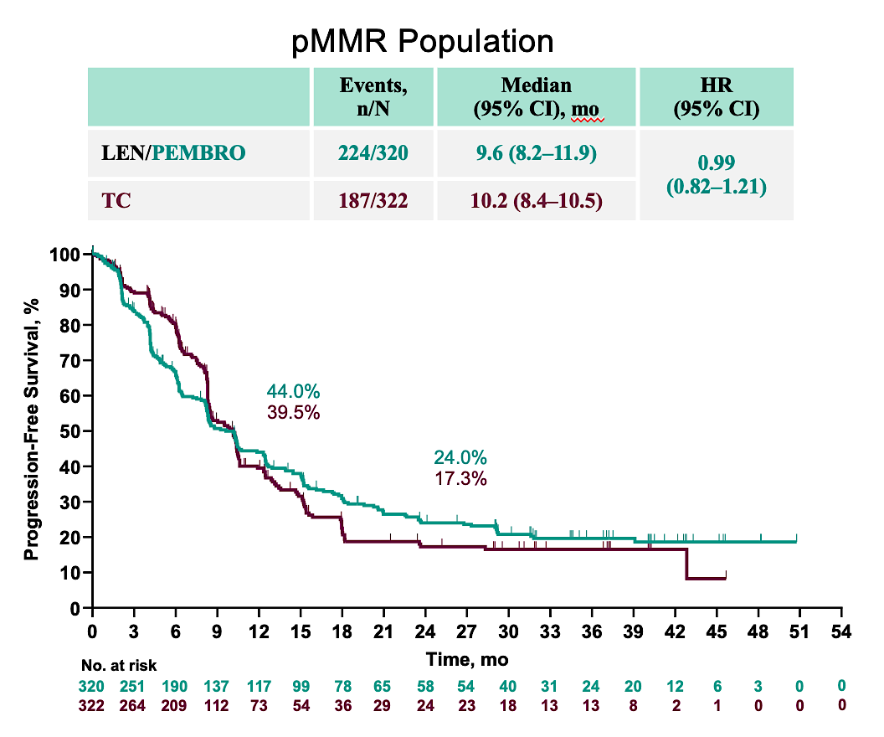
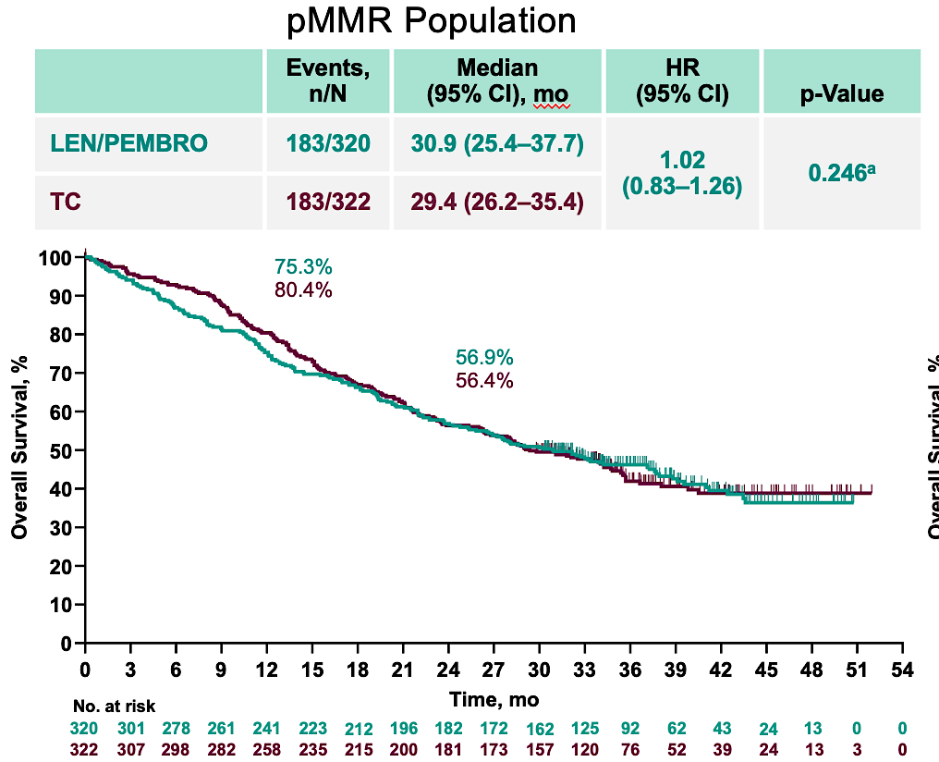
No Difference in PFS and OS
LEN/PEM and TC in pMMR
Marth ESGO 2024, SGO 2024

Slide 66
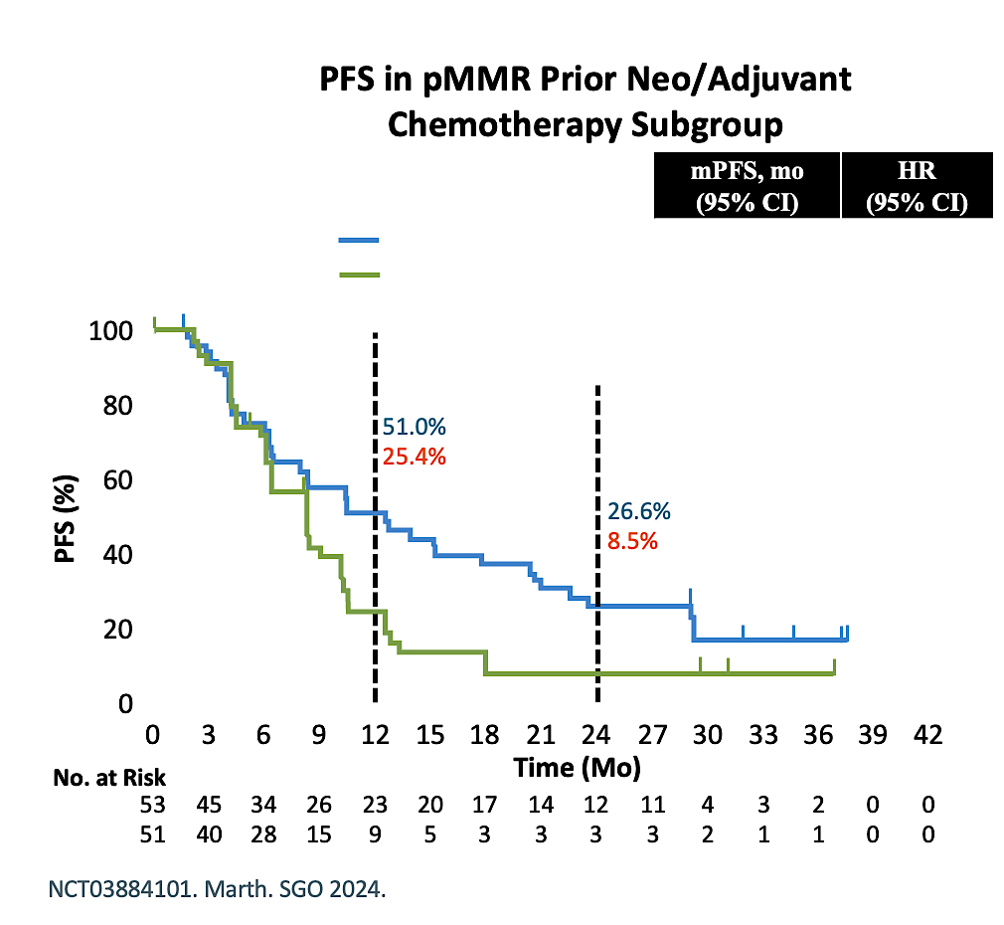
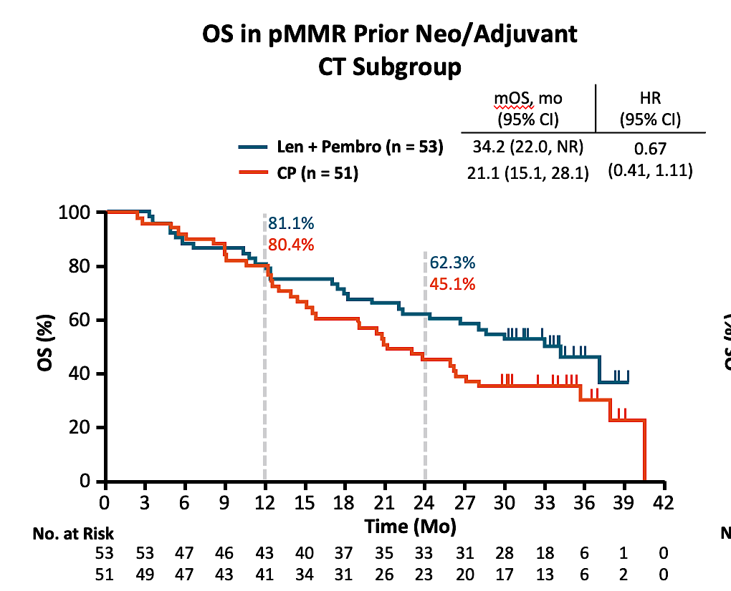
LEAP-001: PFS and OS in
Prior Neo/Adjuvant CT Subgroup
Marth ESGO 2024, SGO 2024

Slide 67
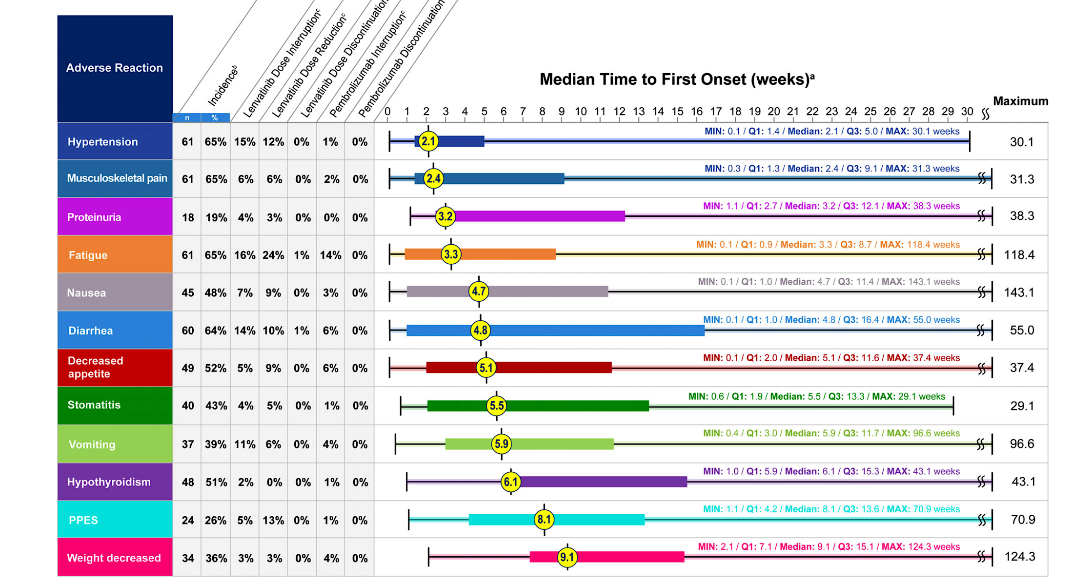
Len/Pem Toxicity Timing
Makker et al. Oncologist 2021

Slide 68
Specific Guidelines for Toxicity Management for Len/Pem
Hypertension
Daily monitoring
Consideration of antihypertensive Rx
Diarrhea
Reporting
Antimotility agents
Consider the timeline
Dose interruption
Fatigue
Rule out other causes
Exercise
Dose interruption/reduction
Nausea
Prophylactic antiemetics
High fat foods
Small frequent meals
Makker. Oncologist 2021

Slide 69
Management of AEs in IO Plus TKI Therapy
Two mechanisms of action result in two sets of AE profiles that are not mutually exclusive
It is important to determine which therapy is causing the AE in order to plan a management strategy
IO + TKI Combination Toxicities
Overlapping
Rash
Diarrhea
Fatigue
Hepatitis
Hypothyroid
AMS
TKI
Hypertension Taste changes Stomatitis Dyspepsia Cytopenia HFSR
IO
Pruritus Pneumonitis Myocarditis Adrenal crisis
Encephalitis
PRES

Slide 70
Prevention/Management AEs
Lower starting dose
Early recognition
Clarification of cause
  Hold TKI
Outpatient vs. inpatient
Initiation of corticosteroid therapy (grade ≥ 2)
  1-2 mg/kg/day methylprednisolone
  Slow steroid taper over 4-6 weeks
  Prevention of adverse events
Consultation

Slide 71
Discussion Questions
67 yo woman
Stage IVB pMMR endometrioid endometrial carcinoma (lung and omental metastases).
BMI 38, type 2 diabetes, hypertension.
First-line carboplatin/paclitaxel/pembrolizumab → partial response but disease progression at 14 months (new liver metastases). Second-line lenvatinib + pembrolizumab → grade 3 hypertension, grade 2 proteinuria, lenvatinib dose reduction to 14 mg, then 10 mg.
I’d like to learn how the investigators titrate the lenvatinib dose — do you start at the recommended dose and reduce as needed or start low and escalate?

Slide 72
Discussion Questions (Continued)
67 yo woman
Stage IVB pMMR endometrioid endometrial carcinoma (lung and omental metastases).
BMI 38, type 2 diabetes, hypertension.
First-line carboplatin/paclitaxel/pembrolizumab → partial response but disease progression at 14 months (new liver metastases). Second-line lenvatinib + pembrolizumab → grade 3 hypertension, grade 2 proteinuria, lenvatinib dose reduction to 14 mg, then 10 mg.
Beyond dose modification, what strategies for side-effect prevention and management do the experts recommend to safely and effectively employ pembrolizumab/lenvatinib?

Slide 73
Discussion Questions (Continued)
67 yo woman
Stage IVB pMMR endometrioid endometrial carcinoma (lung and omental metastases).
BMI 38, type 2 diabetes, hypertension.
First-line carboplatin/paclitaxel/pembrolizumab → partial response but disease progression at 14 months (new liver metastases). Second-line lenvatinib + pembrolizumab → grade 3 hypertension, grade 2 proteinuria, lenvatinib dose reduction to 14 mg, then 10 mg.
What would you use in the second line if a pMMR patient is progressing on chemo-IO? Do you consider IO rechallenge with lenvatinib/pembrolizumab in this setting?
What would you offer third line? Any ADC trials of interest?

Slide 74
Discussion Questions
67 yo woman, metastatic endometrial cancer, pMMR, declines chemotherapy.
Treated with 1L lenvatinib + pembrolizumab. Now with stable disease.
Do you agree with first-line lenvatinib/pembrolizumab in this situation given the patient’s refusal of chemotherapy?
If this had been MSI-high disease, would we need chemo versus single-agent IO? What about for POLE-mutant tumors?

Slide 75
Discussion Questions
58 yo woman
Stage IIIC2 serous endometrial carcinoma (para-aortic nodal metastases), pMMR, TP53-abnormal, BRCA1 somatic mutation.
Debulking surgery → first-line carboplatin/paclitaxel + dostarlimab → complete response after 6 cycles. Started maintenance with dostarlimab + niraparib. Tolerated well for 10 months, then developed recurrent disease (peritoneal carcinomatosis).
How would you have provided care for this patient, and what would you do now?

Slide 76
Discussion Questions (Continued)
58 yo woman
Stage IIIC2 serous endometrial carcinoma (para-aortic nodal metastases), pMMR, TP53-abnormal, BRCA1 somatic mutation.
Debulking surgery → first-line carboplatin/paclitaxel + dostarlimab → complete response after 6 cycles. Started maintenance with dostarlimab + niraparib. Tolerated well for 10 months, then developed recurrent disease (peritoneal carcinomatosis).
What is the current role of PARP inhibition in BRCA-mutated endometrial cancer? What about pMMR tumors more broadly, given that they don’t benefit as much from chemo-IO alone?
Could we use ctDNA to identify candidates who might benefit from PARP in the maintenance setting?

Slide 77
Discussion Questions
55-year-old woman with advanced pMMR endometrial cancer with a somatic BRCA2 mutation. Completes 6 cycles of carboplatin/paclitaxel and is started on maintenance olaparib. On cycle 3, she develops grade 2 anemia (hemoglobin 8.2 g/dL), nausea and moderate fatigue.
Do you support this approach, or is IO absolutely necessary?
What are the expected toxicities requiring dose modification or supportive care with PARP inhibitor maintenance in EC, and how frequently should hematologic parameters be monitored during maintenance therapy?
What is the ideal dosage with olaparib in this situation?

Slide 78
Discussion Questions (Continued)
55-year-old woman with advanced pMMR endometrial cancer with a somatic BRCA2 mutation. Completes 6 cycles of carboplatin/paclitaxel and is started on maintenance olaparib. On cycle 3, she develops grade 2 anemia (hemoglobin 8.2 g/dL), nausea and moderate fatigue.
Are there data to support PARP inhibitor rechallenge after treatment interruption?
Would you consider switching to an alternative PARP inhibitor? For a patient with controlled disease but worsening fatigue and cytopenias, what supportive care interventions have been most helpful in maintaining treatment tolerance?

Slide 79
Agenda
Module 1: Current Up-Front Chemoimmunotherapeutic Approaches for Advanced Endometrial Cancer (EC) — Dr Backes
Module 2: Current and Future Role of Anti-PD-1/PD-L1 Antibodies in Combination with Systemic Therapies Beyond Chemotherapy for Advanced EC — Dr Westin
Module 3: Promising Agents Under Investigation for EC — Dr Slomovitz

Slide 80


Promising Agents Under investigation for the Management of Patients with Endometrial Cancer
Brian M. Slomovitz, MD, FACOG
Director, Gynecologic Oncology, Mount Sinai Medical Center
Professor, Obstetrics and Gynecology, Florida International University
Member, Board of Directors, GOG Foundation
Uterine Cancer Clinical Trial Lead, GOG Partners
Miami Beach, FL

Slide 81

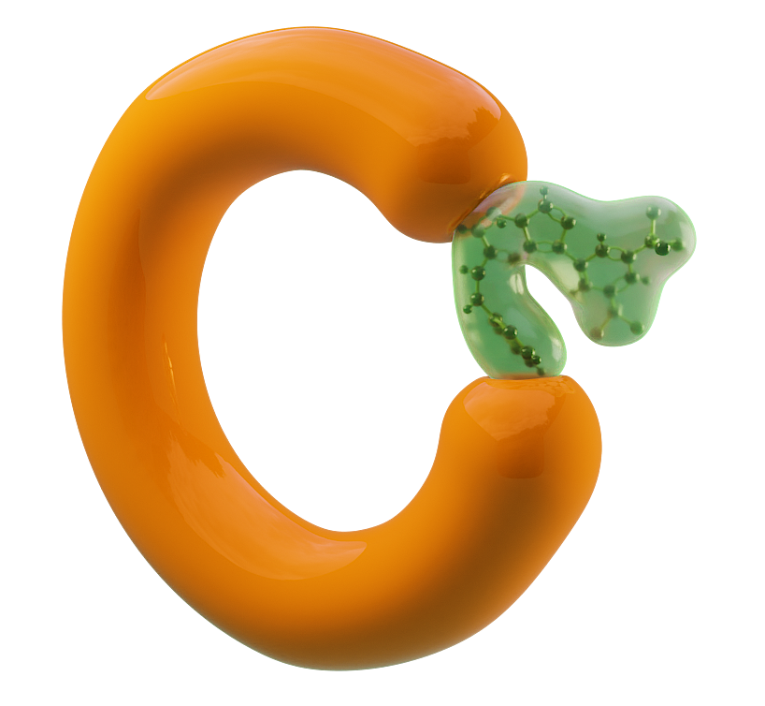






Selinexor Is a Targeted Oral XPO1 Inhibitor
XPO1 inhibition by Selinexor results in:
Nuclear retention and functional reactivation of TSPs (eg, p53), which selectively kill cancer cells and largely spare normal cells
Inhibition of mRNA export of select oncogenes, thus decreasing subsequent translation and synthesis of oncoproteins
Simultaneous targeting of several oncogenic pathways involved in
cancer development, maintenance,
and progression
Nucleus
XPO1
(nuclear export)
Selinexor
Oncoproteins and growth regulators
BCR-ABL
PI3K/AKT
Wnt/β-catenin
AP-1
NF-kB
eIF4E
Nuclear pore complex
Tumor suppressor proteins (TSPs)
p53
p21
p27
FOXO
Cytoplasm
Tai Y-T, et al. Leukemia. 2014; Gandhi UH, et al. Clin Lymphoma Myeloma Leuk. 2018; Sun Q, et al. Signal Transduct Target Ther. 2016.

Slide 82
ENGOT-EN5/GOG-3055/SIENDO:
PFS in ITT and TP53 WT Population
TP53^{WT}
1.00
Selinexor
Placebo
Censored
Probability of Progression-Free Survival
72.4%
vs
66.4%
Selinexor
Placebo
Censored
Progression-Free Survival
1.00
0.75
48.2%
vs
40.9%
Selinexor (n = 77): 28.4 mo (95% CI, 13.1-NR)
Placebo (n = 36): 5.2 mo (95% CI, 2.0-13.1)
HR: 0.44 (95% CI, 0.27-0.73)
One-sided nominal P-value = .0005
0.75
41.7%
vs
34.1%
35.3%
vs
25.8%
0.50
0.50
0.25
0.25
0.00
0.00
0
3
6
9
12
15
18
0
3
6
9
12
15
18
21
24
27
30
33
36
Time (Months)
Months
Median follow-up: 10.2 months (95% CI 8.97, 13.57)
Median follow-up: 36.8 months
Vergote I, et al. J Clin Oncol. 2023; Makker V, et al. Gynecol Oncol. 2024; Slomovitz BM, et al. J Clin Oncol. 2023

Slide 83
XPORT-EC-042: A Phase 3 of Selinexor in Maintenance Therapy After Systemic Therapy for Patients With TP53 Wild-type, Advanced, or Recurrent EC
Prescreening Consent Tissue Sent to Foundation
Study Consent
Primary Endpoint
PFS assessed by Investigator
Key Secondary Endpoint
OS
Secondary Endpoints
Safety
TFST
TSST
PFS2
PFS as assessed by BICR
HR-QoL
Exploratory Endpoints
PFS per histology subtypes
PFS per other molecular features
CR rate among patients with PR as best response
Duration of CR among patients who enter study as PR and achieve CR during study
analysis of tumor biomarkers
PK analysis
Key Eligibility
TP53 wild-type endometrial cancer testing by FMI
Primary stage IV or first recurrent EC
Received at least 12 weeks of platinum-based chemotherapy +/- immunotherapy
Carcinosarcomas allowed; clear cell/small cell carcinoma excluded
N=220
Selinexor 60mg PO QW until PD n = 110
PR/CR
per RECIST v1.1
R
1:1
Treat until progression or intolerability
Placebo weekly until PD
n = 110
Stratification:
Primary Stage IV vs recurrent disease after platinum-based treatment
PR vs CR
*118 PFS events needed to provide 90% power to detect a HR of 0.55 with a 2-sided alpha of 0.05.
CT.gov:NCT05611931

Slide 84
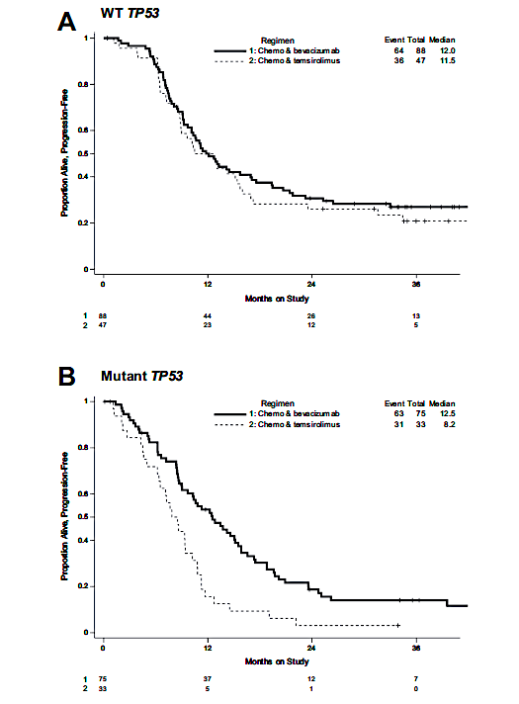

P53 mutation as a “biomarker” for response to Bevacizumab in Endometrial Cancer: Ancillary Investigation of GOG 86P
HR 1.05
HR 0.87
HR 0.61
HR 0.48
Leslie K. et al. Gyncol Oncol 2021

Slide 85


NRG-GY035 A Randomized Phase III Trial of Carboplatin, Paclitaxel, Pembrolizumab Versus Carboplatin, Paclitaxel, Bevacizumab Versus Carboplatin, Paclitaxel, Pembrolizumab, Bevacizumab in the Treatment of pMMR, TP53 Mutated Advanced or Recurrent Endometrial Cancer
SYMBIOTIC-GYN-18 (GOG-3145/ENGOT-EN37/APGOT-EN6/LACOG 0426-EVA): Phase 3 Randomized Open Label Study in Advanced or Recurrent Endometrial Cancer Patients with Proficient MMR Status (NCT07578649)
PI: Amanda Nickles Fader PI: Katy Moore
Co-PI: Michael D. Toboni

Slide 86
ADCs in Endometrial Cancer
Antibody
Trop 2
  Sacituzumab govitecan
  Sacituzumab tirumotecan
  Datopotamab deruxtecan
HER 2
  Trastuzumab deruxtecan
B7H4
  Mocertatug rezetecan
  Puxitatug samrotecan (P-Sam)
Alpha Folate Receptor
  Mirvetuximab
  Rinatabart sesutecan
Cytotoxic payload
Linker
ADC Components
Antibody specific for target antigen on cancer cells
High potency cytotoxic payload
Cleavable or non-cleavable linker between antibody and payload

Slide 87

Comparative ORR across ADC targets in EC
)
)
Cross-trial comparisons are illustrative only; populations, prior therapy, and assays differ.

Slide 88


DESTINY-PanTumor02 ‒ Final Analysis (confirmed ORR)
Gynecological cohort
FINAL ANALYSIS
Median (range) follow up
(all cohorts) – 12.98 (0.4‒47.4) months
PRIMARY ANALYSIS
Median (range) follow up
(all cohorts) – 12.75 (0.4‒31.6) months
FDA granted accelerated approval to trastuzumab deruxtecan for unresectable or metastatic HER2-positive solid tumors in April 2024.

Slide 89

Phase III DESTINY-Endometrial01 Study
Slomovitz B et al. ESMO 2025

Slide 90
ADJUVANT:
DESTINY-Endometrial02/ GOG-3122/ENGOT-en30/GINECO : A Phase 3, Multicenter, Randomized, Open-label Trial of Trastuzumab Deruxtecan Versus Standard of Care Chemotherapy With or Without Radiotherapy as Adjuvant Treatment for HER2-Expressing (IHC 3+/2+) Endometrial Cancer
Tissue Screening
Main Screening
Treatment
Follow-up
Key Patient Population
Histologically confirmed diagnosis of endometrial cancer
FIGO2023 Stage IIC or III
NO evidence of disease post-surgery as per investigator and confirmed by BICR
Treatment naïve (systemic therapy) in any setting including the neoadjuvant setting for endometrial cancer
HER2 expression (IHC 3+/2+) per 2016 ASCO CAP gastric cancer IHC scoring guidelines by central confirmation
T-DXd Q3W 5.4 mg/kg
× 17 cycles +/- concomitant or subsequent VCB
Post-Systemic Therapy 40day Visit 1
LTSFU
1:1
N= 710
Optional Predetermined Radiotherapy
Post-RT 40D Visit 2
SoC Chemotherapy* +/- concomitant or subsequent VCB
*SoC Chemotherapy +/- EBRT Options
6 cycles of carboplatin AUC 5 or 6 and paclitaxel 175 mg/m2 Q3W followed by EBRT
4 cycles carboplatin AUC 5 or 6 and paclitaxel 175 mg/m2 Q3W followed by chemoradiotherapy (EBRT plus cisplatin 50 mg/m2 on days 1 and 29
6 cycles of carboplatin AUC 5 or 6 and paclitaxel 175 mg/m2 Q3W
NCT07022483

Slide 91

Phase I/II Trial Sacituzumab Tirumotecan (Sac-TMT) in Advanced/Metastatic Endometrial Carcinoma
Wang, et al 111P, ESMO 2025

Slide 92

Phase I/II Trial Sacituzumab Tirumotecan (Sac-TMT) in Advanced/Metastatic Endometrial Carcinoma
Wang, et al 111P, ESMO 2025

Slide 93

Phase I/II Trial Sacituzumab Tirumotecan (Sac-TMT) in Advanced/Metastatic Endometrial Carcinoma
Wang, et al 111P, ESMO 2025

Slide 94

Phase I/II Trial Sacituzumab Tirumotecan (Sac-TMT) in Advanced/Metastatic Endometrial Carcinoma
Wang, et al 111P, ESMO 2025

Slide 95

[The Manufacturer] Announces TroFuse-005 Trial Evaluating Sacituzumab Tirumotecan (Sac-TMT) Met Primary Endpoints of Overall Survival (OS) and Progression-Free Survival (PFS) in Certain Patients with Advanced or Recurrent Endometrial Cancer
RAHWAY, N.J.--(BUSINESS WIRE)-- [The manufacturer] today announced the pivotal Phase 3 TroFuse-005 trial evaluating sacituzumab tirumotecan (sac-TMT), an investigational TROP2-directed antibody-drug conjugate (ADC) […] met its primary endpoints of overall survival (OS) and progression-free survival (PFS) in certain patients with

Slide 96
TroFuse-005 Phase III Trial Design
Sac-TMT
Estimated enrollment N = 710
Patients with endometrial cancer who received prior platinum-based chemotherapy and PD-1/PD-L1 therapy, either separately or in combination
R
TPC
Primary endpoint: PFS, OS
https://clinicaltrials.gov/study/NCT06132958. Accessed May 2026.

Slide 97
TroFuse-033 Phase III Trial Design
Maintenance Phase
Sac-TMT + Pembrolizumab
Estimated enrollment N = 710
Patients with primary advanced or recurrent endometrial cancer that is pMMR All undergo an induction phase of 6 cycles comprised of pembrolizumab + carboplatin + paclitaxel or docetaxel
R
Pembrolizumab
Primary endpoint: PFS, OS
https://clinicaltrials.gov/study/NCT06952504. Accessed May 2026.

Slide 98

Efficacy and Safety of Sacituzumab Govitecan in Patients With Advanced Solid Tumors (TROPiCS-03): Analysis in Patients With Advanced Endometrial Cancer
Santin AD, Corr BR, J Clin Oncol. 2024 Oct 10;42(29):3421-3429

Slide 99

Efficacy and Safety of Sacituzumab Govitecan in Patients With Advanced Solid Tumors (TROPiCS-03): Analysis in Patients With Advanced Endometrial Cancer
Santin AD, Corr BR, J Clin Oncol. 2024 Oct 10;42(29):3421-3429

Slide 100

Efficacy and Safety of Sacituzumab Govitecan in Patients With Advanced Solid Tumors (TROPiCS-03): Analysis in Patients With Advanced Endometrial Cancer
Santin AD, Corr BR, J Clin Oncol. 2024 Oct 10;42(29):3421-3429

Slide 101

Phase III ASCENT-GYN-01 Study
Eskander RN et al. IJGC 2025

Slide 102
T-pamirtecan (DB-1303/BNT323) in HER2-expressing, recurrent endometrial cancer
73.1
(52.2, 88.4)
70.8
(48.9, 87.4)
Local testing (N=142)^{b}
Central testing (N=96)
Confirmed ORR, % (95% CI)
40.4
(27.6, 54.2)
44.2
(29.1, 60.1)
33.9
(22.1, 47.4)
34.5
(17.9, 54.3)
n=59
n=29
n=57
n=43
n=26
n=24
HER2 IHC 1+
HER2 IHC 2+
HER2 IHC 3+
ªBy IRC in the modified FAS, which includes patients who received ≥1 dose of trastuzumab pamirtecan and had at least one measurable lesion as assessed by IRC at baseline according to RECIST v1.1; ^{b}IHC score was not available for one patient; patient tested positive by ISH.

Slide 103

Mocertatug Rezetecan (GSK5733584), a B7-H4 Targeted Antibody-Drug Conjugate in EC: First Results from the Global BEHOLD-1 Study
Confirmed ORR was 67% (n=8/12) in patients with EC at the 4.8 mg/kg Q3W dose
Mo-Rez 2.8 mg/kg (N=11)
Mo-Rez 4.8 mg/kg (N=12)
30
PD
SD
30
20
SD
20
10
PD
SD
SD
SD
SD
SD
SD
PR
10
0
0
SD
SD
PR
SD
PR
PR
PR
PR
PR
PR
PR
-10
-10
-20
-20
-30
-30
Best % change from baseline in sum of TL diameters†
-40
-40
-50
-50
-60
-60
-70
-70
-80
-80
-90
cORR*: 9% (95% CI: 0.2, 41)
-90
cORR*: 67% (95% CI: 35, 90)
-100
-100
Responses were observed across a range of B7-H4 expression levels
Median (IQR) follow-up was 4.0 (1.7, 5.8) months for the overall cohort (N=49)
Efficacy population: N=23.
*Confirmed ORR reported in all randomized patients who had the opportunity for ≥18 weeks of follow-up; †waterfall plots show confirmed best overall response for patients with at least one post-baseline tumor assessment.
B7-H4, B7 homolog 4 protein; c, confirmed; CI, confidence interval; EC, endometrial cancer; IQR, interquartile range; Mo-Rez, mocertatug rezetecan; ORR, objective response rate; PD, progressive disease; PR, partial response; Q3W, every 3 weeks; SD, stable disease; TL, target lesion.

Slide 104
Puxitatug samrotecan (P-Sam): a B7-H4–targeting TOP1i ADC
Efficacy was observed in patients with EC across B7-H4 expression
100
Confirmed ORR:
2.0 mg/kg: 9/26 (34.6%)
2.4 mg/kg: 10/26 (38.5%)
80
60
40
20
*
RECIST v1.1 response
Best percentage change from baseline in
target lesion size (%)
PD
0
SD
−20
uPR
PR
−40
CR
−60
B7-H4 expression
−80
≥75%
≥50% to <75%
−100
≥25% to <50%
RECIST v1.1 response
Prior PD-(L)1 inhibitor
B7-H4 expression
yes
Prior PD-(L)1 inhibitor
no
unknown
Includes patients who had the opportunity for ≥13 weeks of follow-up at data cut-off: January 30, 2025
*Patient was discontinued prior to first evaluation scan
CR, complete response; ORR, objective response rate; PD, progressive disease; PD-(L)1, programmed cell death (ligand) 1; PR, partial response; RECIST v1.1, Response Evaluation Criteria in Solid Tumors version 1.1; SD, stable disease; uPR, unconfirmed partial response
Presented at SGO Annual Meeting, 2025, Seattle, WA

Slide 105
Rinatabart sesutecan (Rina-S®) for patients with advanced or recurrent endometrial cancer (a/r EC): Update from dose expansion cohort B2 of RAINFOL™-01
Antitumor Activity
 | 100 mg/m² (n=22) | 120 mg/m² (n=34)ª
Median on-study follow-up^{b}, months (95% CI) | 11.7 (11.3-12.4) | 13.8 (11.5-16.5)
Confirmed ORR^{c}, % (95% CI) | 50.0 (28.2-71.8) | 44.1 (27.2-62.1)
Confirmed response, n (%)
CR | 2 (9.1) | 1 (2.9)
PR | 9 (40.9) | 14 (41.2)
SD | 11 (50.0) | 13 (38.2)
NE | 0 | 1 (2.9)
DCR, % (95% CI) | 100 (84.6-100.0) | 82.4 (65.5-93.2)
ªResponse-evaluable population (includes patients with ≥1 post-baseline scan). ^{b}Median on-study follow-up is the median time from first dose to censoring for all patients at data cutoff. ^{c}Based on investigator assessment.
CR, complete response; DCR, disease control rate; NE, not evaluable; ORR, objective response rate; PR, partial response; SD, stable disease

Slide 106
Pivotal Phase 3 trials in post-platinum / post-IO recurrent EC
Trial / ID | Agent | Target & selection | Sponsor / Status
GOG-3095: TroFuse-005 NCT06132958 | Sacituzumab tirumotecan (sac-TMT) | TROP2 | Merck × Kelun-Biotech ✓ POSITIVE READOUT MAY 18, 2026
GOG-3104: ASCENT-GYN-01 NCT06486441 | Sacituzumab govitecan (SG) | TROP2 | Gilead
GOG 3105: Fern-EC-01 NCT06340568 | Trastuzumab pamirtecan | HER2 IHC 1+, 2+, 3+ (central) | BioNTech × DualityBio Enrolling
GOG 3110: Bluestar-01 NCT07044336 | Puxitatug samrotecan (Puxi-Sam) | B7H4 | AstraZeneca enrolliing
GOG-3128 / RAINFOL-03 NCT07166094 | Rinatabart sesutecan (Rina-S) | FRα | Genmab enrolling
GOG-3031/BEHOLD-Endometrial 01 | Mocertatug Rezetecan (Mo Rez) | B7H4 | GSK Enrolling
BEHOLD-Endometrial 02 NCT06796907 | Mocertatug rezetecan (Mo Rez) | B7H4
References: ClinicalTrials.gov accessed May 2026: NCT06132958, NCT06865677, NCT06340568, NCT07166094. Merck press release May 18, 2026; Genmab press release Oct 2025; BioNTech press release Apr 2026.

Slide 107
Discussion Questions
58-year-old woman with advanced MSS endometrial cancer, TP53 wild type
Do the faculty test for aberrant TP53 expression in all of their patients at initial diagnosis? Or only certain ones, like those with MSS/pMMR disease?
When is the Phase III trial of selinexor in TP53 wild-type disease expected to be reported?
Given that selinexor is already accessible in other tumor types, should we be trying to access it for our patients with TP53 wild-type disease, particularly those with pMMR?
If selinexor were available for TP53 wild-type advanced EC, would you employ it together with an anti-PD-1/PD-L1 antibody in the maintenance setting for a patient who received up-front chemoimmunotherapy?
If approved, what tolerability issues are likely with selinexor, and how will these be prevented and managed?

Slide 108
Discussion Questions
58-year-old with Stage III serous endometrial cancer, p53-mutant, MMR-proficient. Received carboplatin/paclitaxel first line, progressed at 10 months. Started lenvatinib/pembrolizumab second line with further progression.
What is the next option? Given the recent press release, do you think sac-TMT will soon be an option for patients like this?
What is known about other TROP2 ADCs in EC? Have any of the faculty members seen meaningful responses with sacituzumab govitecan? Are there any circumstances in which you would attempt to access off-label sacituzumab govitecan, given its availability in other tumor types and the indications of efficacy with TROP2-targeted agents in EC?

Slide 109
Discussion Questions (Continued)
58-year-old with Stage III serous endometrial cancer, p53-mutant, MMR-proficient. Received carboplatin/paclitaxel first line, progressed at 10 months. Started lenvatinib/pembrolizumab second line with further progression.
If TROP2 ADCs reach the clinic in EC, how, when and for whom do you envision we’ll be using them? For a patient progressing on first-line chemoimmunotherapy, would a TROP2 ADC be preferable to lenvatinib/pembrolizumab given its alternative mechanism of action?
How likely is it that TROP2 ADCs will eventually move forward in the treatment sequence?
What are the most common toxicities of sac-TMT? Are they identical to sacituzumab govitecan, or are there considerable differences?

Slide 110
Discussion Questions
63-year-old woman s/p multiple treatments for metastatic pMMR EC. HER2 IHC 2+. T-DXd resulted in a meaningful clinical response with improvement in symptoms, reduction in tumor burden and radiographic partial response, which was sustained.
For a patient with pMMR, HER2-positive EC, would the faculty favor carbo/paclitaxel with IO or with trastuzumab as frontline therapy? Is there any way of predicting which of these will benefit these patients most? Would you ever use both?
How should we sequence pembro/lenvatinib relative to HER2-directed therapy for patients with R/R disease who are eligible for both?

Slide 111
Discussion Questions (Continued)
63-year-old woman s/p multiple treatments for metastatic pMMR EC. HER2 IHC 2+. T-DXd resulted in a meaningful clinical response with improvement in symptoms, reduction in tumor burden and radiographic partial response, which was sustained.
Any tips on managing nausea/asthenia in patients receiving T-DXd? What is the optimal approach to screening for ILD?
What is the next step in this patient’s treatment? Could we try off-label
use of a HER2-targeted drug that has proven effective in other tumor types,
like zanidatamab?
Would a TROP2 ADC be a reasonable option for this patient? Given both T-DXd and the various TROP2 ADCs have topoisomerase I payloads, would you be comfortable sequencing them?

Slide 112
What Clinicians Want to Know: Addressing Community
Oncologists’ Questions About the Current and Future Role of
Antibody-Drug Conjugates in the Management of Breast Cancer
A CME Symposium Held Adjunct with the 2026 ASCO® Annual Meeting
Monday, June 1, 2026
7:00 PM – 9:00 PM CT (8:00 PM – 10:00 PM ET)
Faculty
Professor Giuseppe Curigliano, MD, PhD
Rebecca A Dent, MD, MSc
Erika Hamilton, MD
Nadia Harbeck, MD, PhD
Moderator
Hope S Rugo, MD

Slide 113
Second Opinion: Investigators Provide Perspectives on the Current and Future Use of Novel Therapies for Non-Hodgkin Lymphoma
A CME Symposium Held Adjunct with the 2026 ASCO® Annual Meeting
Monday, June 1, 2026
7:00 PM – 9:00 PM CT (8:00 PM – 10:00 PM ET)
Faculty
Christopher Flowers, MD, MS, FASCO
Matthew Lunning, DO
Sonali M Smith, MD
Moderator
Brad S Kahl, MD

Slide 114
Consensus or Controversy? Documenting and Discussing Investigators’ Approaches to the
Management of Relapsed/Refractory Multiple Myeloma
A CME Symposium Held Adjunct with the 2026 ASCO® Annual Meeting
Monday, June 1, 2026
7:00 PM – 9:00 PM CT (8:00 PM – 10:00 PM ET)
Faculty
Melissa Alsina, MD
Hans Lee, MD
Paul G Richardson, MD
Moderator
Sagar Lonial, MD, FACP, FASCO

Slide 115
Thank you for joining us!
Your feedback is very important to us.
Please complete the survey currently up on the iPads for attendees in the room and on Zoom for those attending virtually. The survey will remain open up to 5 minutes after the meeting ends.
How to Obtain CME Credit
In-person attendees: Please refer to the program syllabus for the CME credit link or QR code. Online/Zoom attendees:
The CME credit link is posted in the chat room.

