Slide 1
Consensus or Controversy?
Documenting and Discussing Investigators’
Approaches to the Management of Colorectal Cancer
Friday, May 29, 2026
6:30 PM – 8:00 PM CT (7:30 PM – 9:00 PM ET)
Faculty
Stacey A Cohen, MD
Arvind Dasari, MD, MS
Moderator
Tanios Bekaii-Saab, MD

Slide 2

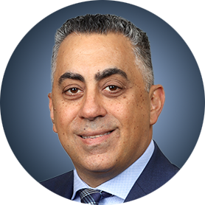

Faculty
Stacey A Cohen, MD
Professor
Fred Hutchinson Cancer Center
University of Washington
Seattle, Washington
Moderator
Tanios Bekaii-Saab, MD
David F and Margaret T Grohne Professor of Novel Therapeutics for Cancer Research I
Professor, Mayo Clinic College of Medicine and Science
Chair and Consultant, Division of Hematology and Medical Oncology
Mayo Clinic in Arizona
Phoenix, Arizona
Arvind Dasari, MD, MS
Professor
Department of Gastrointestinal Medical Oncology
The University of Texas MD Anderson Cancer Center
Houston, Texas

Slide 3



Contributing Clinical Investigators
Marwan Fakih, MD
Professor, Medical Oncology and Therapeutics Research
Division Head, GI Medical Oncology
Deputy Director
City of Hope Comprehensive Cancer Center
Duarte, California
Anwaar Saeed, MD
Associate Professor
University of Pittsburgh School of Medicine
Section Chief, Gastrointestinal Oncology
Director, Gastrointestinal Disease Center
Co-Leader, Cancer Therapeutics Program
UPMC Hillman Cancer Center
Pittsburgh, Pennsylvania
Christopher Lieu, MD
Professor of Medicine
Associate Director for Clinical Research
Director, GI Medical Oncology
University of Colorado Cancer Center
Aurora, Colorado

Slide 4
Andrea Cercek, MD — Disclosures
PowerPoint Slides
Advisory Boards | 3T Biosciences, AbbVie Inc, Agents, Amgen Inc, Daiichi Sankyo Inc, GSK, Janssen Biotech Inc, Merck, Pfizer Inc, Regeneron Pharmaceuticals Inc, Roche Laboratories Inc, Summit Therapeutics, UroGen Pharma
Contracted Research | GSK, Pfizer Inc

Slide 5
Dr Cohen — Disclosures
Faculty
Advisory Committees | AbbVie Inc, Blueprint Medicines, Boston Scientific Corporation, Caris Life Sciences, DoMore Diagnostics, Exact Sciences Corporation, Incyte Corporation, Janssen Biotech Inc, Merck, Pfizer Inc, Roche Laboratories Inc
Data and Safety Monitoring Boards/Committees | GSK

Slide 6
Dr Dasari — Disclosures
Faculty
Advisory Committees | Agenus Inc, Bristol Myers Squibb, Exelixis Inc, Illumina, Lantheus, Personalis, Sanofi, Taiho Oncology Inc, Takeda Pharmaceuticals USA Inc
Contracted Research | Bristol Myers Squibb, Crinetics Pharmaceuticals, Eisai Inc, Enterome, Guardant Health, Hutchison MediPharma, Natera Inc, NeoGenomics, Personalis, RayzeBio, Taiho Oncology Inc, Xencor

Slide 7
Dr Bekaii-Saab — Disclosures
Moderator
Consulting Agreements (to Institution) | Arcus Biosciences, Bayer HealthCare Pharmaceuticals, Eisai Inc, Genentech, a member of the Roche Group, Incyte Corporation, Ipsen Biopharmaceuticals Inc, Merck, Merck KGaA, Merus, Pfizer Inc, Revolution Medicines Inc, Seagen Inc, Servier Pharmaceuticals LLC
Consulting Agreements (to Self) | AbbVie Inc, Aptitude Health, Arsenal Biosciences Inc, AstraZeneca Pharmaceuticals LP, BeOne, Blueprint Medicines, Boehringer Ingelheim Pharmaceuticals Inc, Celularity, Daiichi Sankyo Inc, Deciphera Pharmaceuticals Inc, Exact Sciences Corporation, Exelixis Inc, Foundation Medicine, GSK, Illumina, Janssen Biotech Inc, Kanaph Therapeutics, Lisata Therapeutics, Natera Inc, Ryght AI, Sanofi, Sobi, Stemline Therapeutics Inc, Takeda Pharmaceuticals USA Inc, Treos Bio, Xilio Therapeutics, Zai Lab
Data and Safety Monitoring Boards/Committees | 1Globe Health Institute, AstraZeneca Pharmaceuticals LP, Eisai Inc, Exelixis Inc, FibroGen Inc, Merck, Suzhou Kintor
Inventions/Patents | WO/2018/183488 — Human PD-1 peptide vaccines and uses thereof, licensed to Imugene, WO/2019/055687 — Methods and compositions for the treatment of cancer cachexia, licensed to Recursion
Research Funding (to Institution) | Agios Pharmaceuticals Inc, AltruBio, Arcus Biosciences, Arrys Therapeutics, a wholly owned subsidiary of Kyn Therapeutics, Atreca, Bayer HealthCare Pharmaceuticals, Bristol Myers Squibb, Celgene Corporation, Eisai Inc, Genentech, a member of the Roche Group, Incyte Corporation, Ipsen Biopharmaceuticals Inc, Lilly, Merus, Mirati Therapeutics Inc, Novartis, Pfizer Inc, pharmaand GmbH, Revolution Medicines Inc, Seagen Inc, Sumitomo Pharma America
Scientific Advisory Boards | Artiva Biotherapeutics Inc, Immuneering Corporation, Imugene, Replimune, Sun Biopharma, Xilis
Nonrelevant Financial Relationships | MJH Life Sciences, Pancreatic Cancer Action Network, The Valley Hospital, UpToDate

Slide 8
Dr Fakih — Disclosures
Contributing Clinical Investigators
Advisory Committees | Genentech, a member of the Roche Group, Janssen Research and Development, Merus, Mirati Therapeutics Inc, Tempus, Xilio Therapeutics
Consulting Agreements | AbbVie Inc, Adagene, Bristol Myers Squibb, Delcath Systems Inc, Iterion Therapeutics, Merck, Microbial Machines, Mirati Therapeutics Inc, Revolution Medicines, Summit Therapeutics, Taiho Oncology Inc, Totus Medicines
Contracted Research | Agenus Inc

Slide 9
Dr Lieu — Disclosures
Contributing Clinical Investigators
Consulting Agreements | Pfizer Inc
Contracted Research | Genentech, a member of the Roche Group, Janssen Biotech Inc

Slide 10
Dr Saeed — Disclosures
Contributing Clinical Investigators
Advisory Committees and Consulting Agreements | Amgen Inc, AstraZeneca Pharmaceuticals LP, Autem Therapeutics, BeOne, Bristol Myers Squibb, Exact Sciences Corporation, Exelixis Inc, KAHR Medical, Merck, Pfizer Inc, Regeneron Pharmaceuticals Inc, Replimune, Taiho Oncology Inc, Xilio Therapeutics
Contracted Research | Actuate Therapeutics, Arcus Biosciences, AstraZeneca Pharmaceuticals LP, Bristol Myers Squibb, Coherus BioSciences, Exelixis Inc, Henlius, Incyte Corporation, KAHR Medical, Merck, Oxford BioTherapeutics, Phanes Therapeutics Inc, Regeneron Pharmaceuticals Inc, Replimune
Data and Safety Monitoring Boards/Committees | Arcus Biosciences

Slide 11
Research To Practice President Neil Love, MD — Disclosures
Dr Love is president and CEO of Research To Practice. Research To Practice receives funds in the form of educational grants to develop CME activities from the following companies: Aadi Bioscience, AbbVie Inc, ADC Therapeutics, Agendia Inc, Alexion Pharmaceuticals, Amgen Inc, Array BioPharma Inc, a subsidiary of Pfizer Inc, Arvinas, Astellas, AstraZeneca Pharmaceuticals LP, Aveo Pharmaceuticals, Bayer HealthCare Pharmaceuticals, BeOne, Biotheranostics Inc, A Hologic Company, Black Diamond Therapeutics Inc, Blueprint Medicines, Boehringer Ingelheim Pharmaceuticals Inc, Bristol Myers Squibb, Celcuity, Clovis Oncology, Coherus BioSciences, Corcept Therapeutics Inc, CTI BioPharma, a Sobi Company, Daiichi Sankyo Inc, Eisai Inc, Elevation Oncology Inc, Exact Sciences Corporation, Exelixis Inc, Genentech, a member of the Roche Group, Genmab US Inc, Geron Corporation, Gilead Sciences Inc, GSK, Helsinn Therapeutics (US) Inc, ImmunoGen Inc, Incyte Corporation, Ipsen Biopharmaceuticals Inc, Jazz Pharmaceuticals Inc, Johnson & Johnson, Karyopharm Therapeutics, Kite, A Gilead Company, Kura Oncology, Legend Biotech, Lilly, MEI Pharma Inc, Merck, Mersana Therapeutics Inc, Mirati Therapeutics Inc, Mural Oncology Inc, Natera Inc, Novartis, Novartis Pharmaceuticals Corporation on behalf of Advanced Accelerator Applications, Novocure Inc, Nuvalent, Nuvation Bio Inc, Pfizer Inc, Pharmacyclics LLC, an AbbVie Company, Puma Biotechnology Inc, Regeneron Pharmaceuticals Inc, Revolution Medicines Inc, Rigel Pharmaceuticals Inc, R-Pharm US, Sanofi, Seagen Inc, Servier Pharmaceuticals LLC, SpringWorks Therapeutics Inc, Stemline Therapeutics Inc, Sumitomo Pharma America, Summit Therapeutics, Syndax Pharmaceuticals, Taiho Oncology Inc, Takeda Pharmaceuticals USA Inc, TerSera Therapeutics LLC, and Tesaro, A GSK Company.

Slide 12
Commercial Support
This activity is supported by educational grants from Exelixis Inc, GSK, and Natera Inc.
Research To Practice CME Planning Committee Members,
Staff and Reviewers
Planners, scientific staff and independent reviewers for Research To Practice have no relevant financial relationships to disclose.

Slide 13
This educational activity contains discussion of
non-FDA-approved uses of agents and regimens. Please refer to official prescribing information for each product for approved indications.

Slide 14



Clinicians in the Meeting Room
Networked iPads are available.
Review Program Slides: Tap the Program Slides button to review speaker presentations and other program content.
Answer Survey Questions: Complete the pre- and postmeeting surveys. Survey questions will be discussed throughout the meeting.
Ask a Question: Tap Ask a Question to submit a challenging case or question for discussion. We will aim to address as many questions as possible during the program.
For assistance, please raise your hand. Devices will be collected at the conclusion of the activity.
Notes:
14

Slide 15

Clinicians Attending via Zoom
Review Program Slides: A link to the program slides will be posted in the chat room at the start of the program.
Answer Survey Questions: Complete the pre- and postmeeting surveys.
Ask a Question: Submit a challenging case or question for discussion using the Zoom chat room.
Get CME Credit: A credit link will be provided in the chat room at the conclusion of the program.
Notes:
15

Slide 16
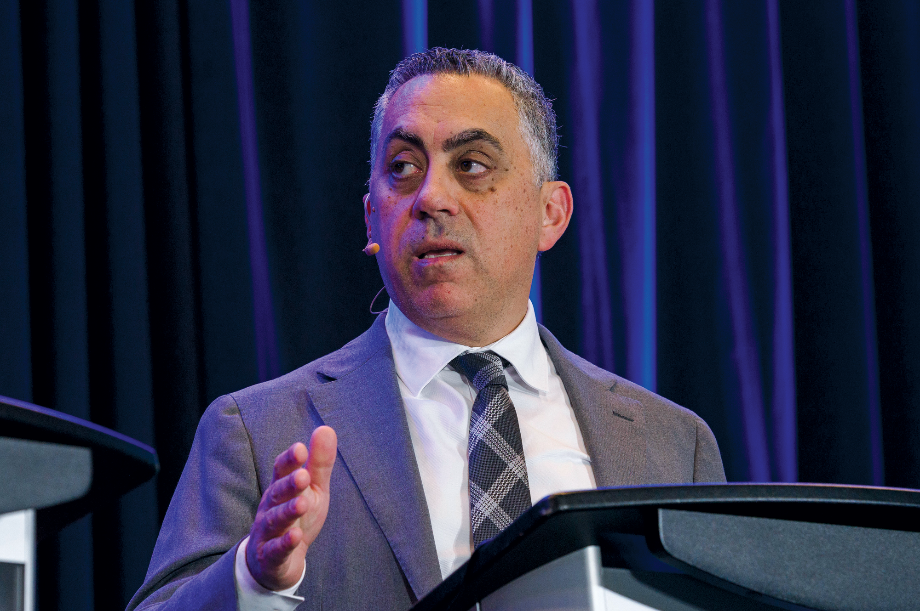
About the Enduring Program
The live meeting is being video
and audio recorded.
The proceedings from today will
be edited and developed into
an enduring web-based program.
An email will be sent to all attendees
when the activity is available.
To learn more about our education programs, visit our website, www.ResearchToPractice.com
Notes:
16
16

Slide 17
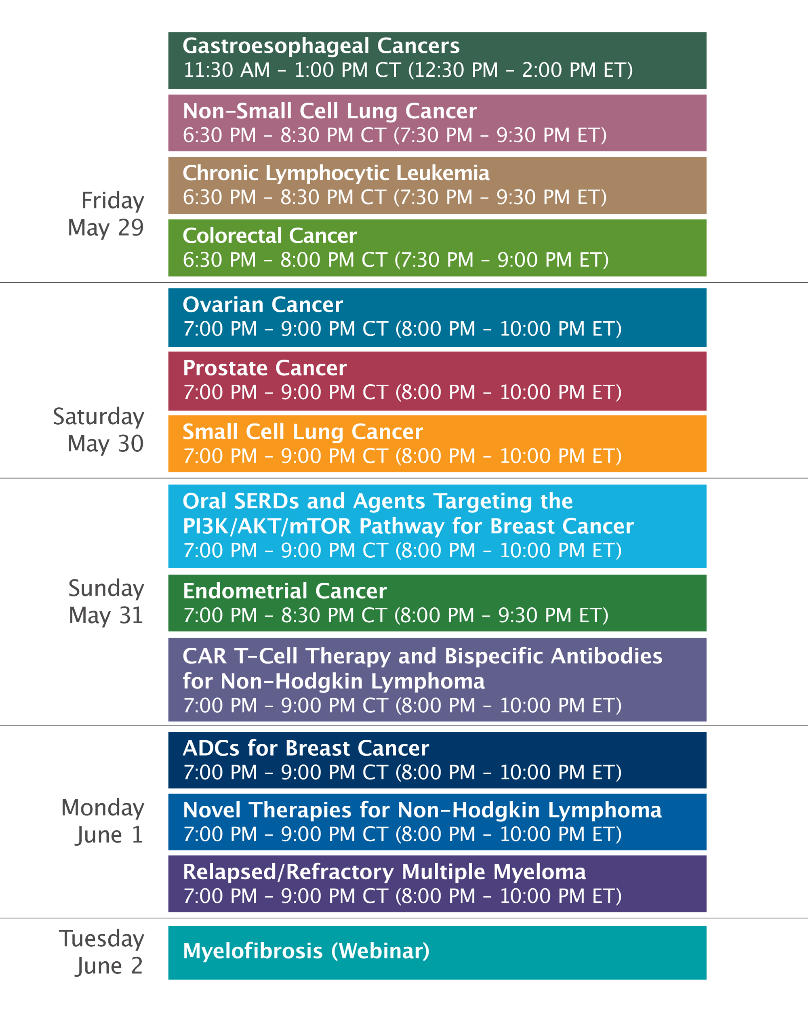

Slide 18
Consensus or Controversy?
Documenting and Discussing Investigators’
Approaches to the Management of Colorectal Cancer
Friday, May 29, 2026
6:30 PM – 8:00 PM CT (7:30 PM – 9:00 PM ET)
Faculty
Stacey A Cohen, MD
Arvind Dasari, MD, MS
Moderator
Tanios Bekaii-Saab, MD

Slide 19
Agenda
Module 1: Current and Future Role of Immune Checkpoint Inhibition in the Management of Microsatellite Instability-High (MSI-H)/Mismatch Repair Deficient (dMMR) Localized and Locally Advanced Colorectal Cancer (CRC) — Dr Cohen
Module 2: Clinical Relevance and Practical Utilization of Molecular Residual Disease (MRD) Analysis in CRC — Dr Dasari
Module 3: Recent Advances in Metastatic CRC (mCRC): Optimizing Immunotherapy and Other Approaches — Dr Bekaii-Saab

Slide 20
Agenda
Module 1: Current and Future Role of Immune Checkpoint Inhibition in the Management of Microsatellite Instability-High (MSI-H)/Mismatch Repair Deficient (dMMR) Localized and Locally Advanced Colorectal Cancer (CRC) — Dr Cohen
Module 2: Clinical Relevance and Practical Utilization of Molecular Residual Disease (MRD) Analysis in CRC — Dr Dasari
Module 3: Recent Advances in Metastatic CRC (mCRC): Optimizing Immunotherapy and Other Approaches — Dr Bekaii-Saab

Slide 21
Current and Future Role of Immune Checkpoint Inhibition in the Management of Microsatellite Instability-High
(MSI-H)/Mismatch Repair Deficient (dMMR) Localized
and Locally Advanced Colorectal Cancer (CRC)
May 29, 2026
Stacey A Cohen, MD
Professor
Fred Hutchinson Cancer Center
University of Washington
Seattle, Washington
Presentation slides courtesy of Andrea Cercek, MD

Slide 22
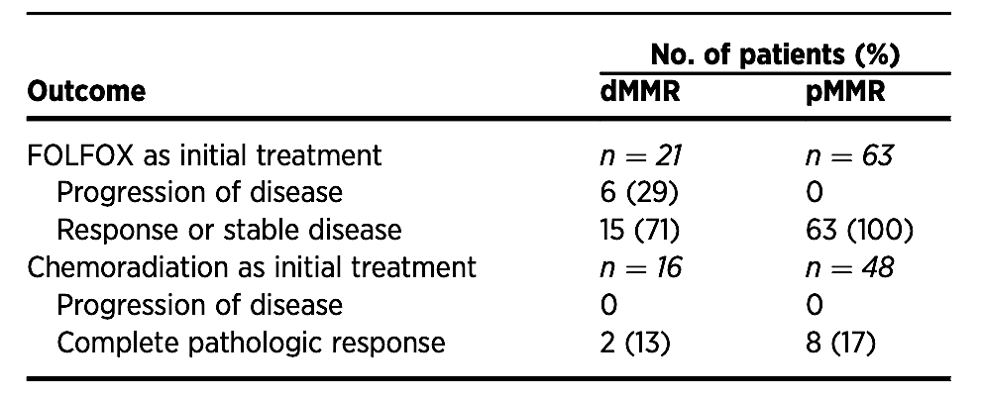
Biomarker selected neoadjuvant therapy: MMRd/MSI
About 5-10% of all rectal cancers
Less sensitive to chemotherapy
Rectal cancer treated with TNT
Slides courtesy of Andrea Cercek, MD
Cercek, Smith, Stadler Clin Cancer Research 2020

Slide 23
Hypothesis
In mismatch repair deficient rectal cancer, PD-1 blockade may be able to either: a) replace chemotherapy b) replace chemo and radiation therapy c) replace chemo and radiation, and surgery
Neoadjuvant PD1 blockade in MMRd locally advanced rectal cancer
Slides courtesy of Andrea Cercek, MD

Slide 24
Neoadjuvant PD1 blockade in MMRd locally advanced rectal cancer
NCT04165772
R21CA252519-01A1
Residual disease
Surgery
Dostarlimab
500mg IV every 3 weeks
6 months
Residual disease
ChemoRT
Radiologic and endoscopic evaluation
Clinical complete response
Clinical complete response
Stage II/III rectal cancer
MMRd by IHC
Target N= 30 (expanded)
Non-operative follow-up every 4 months
Primary Endpoints:
ORR after completion of PD-1 alone or in combination with chemoRT
pCR or sustained cCR for 12 mo after completion of PD1 alone or in combination with chemoRT
Sample Collection: ctDNA, biopsy, imaging
Baseline, 6 weeks, 3 mo, 6 mo and q4 mo during NOM
Slides courtesy of Andrea Cercek, MD

Slide 25
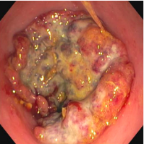
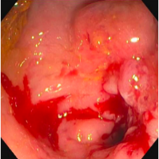
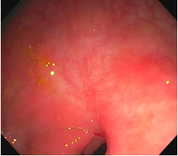
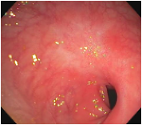
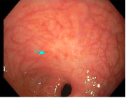
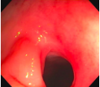
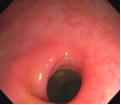
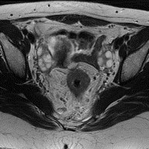
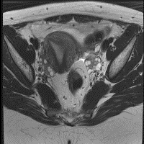
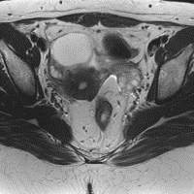
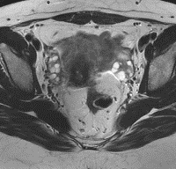
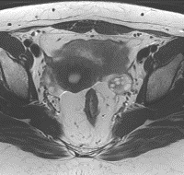
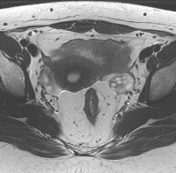
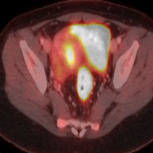
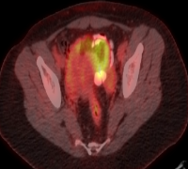
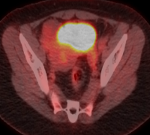
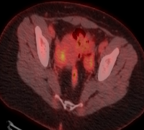
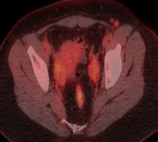
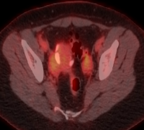
Patient with MMRd rectal cancer
SD / STABLE DISEASE
PR / PARTIAL RESPONSE
NCR / NEAR COMPLETE RESPONSE
CR / COMPLETE RESPONSE
DOSTARLIMAB
BASELINE
6 WEEKS
3 MONTHS
6 MONTHS
FU2 / 14 MONTHS
FU3 / 18 MONTHS
FU4 / 22 MONTHS
ENDOSCOPY
MRI RECTUM
PET/CT
Slides courtesy of Andrea Cercek, MD
Cercek, et al NEJM 2022

Slide 26
Individual responses to PD-1 blockade with dostarlimab
Patients who completed 6-months of dostarlimab
ID | Age | Stage T | Stage N | DFS (months) | Digital rectal exam response | Endoscopic best response | Rectal MRI best response | Overall response
1 | 38 | T4 | N+ | 60.3 | CR | CR | CR | cCR
2 | 30 | T3 | N+ | 60.3 | CR | CR | CR | cCR
3 | 61 | T1/2 | N+ | 60.8 | CR | CR | CR | cCR
4 | 28 | T4 | N+ | 59.1 | CR | CR | CR | cCR
5 | 53 | T1/2 | N+ | 48.8 | CR | CR | CR | cCR
6 | 77 | T1/2 | N+ | 50.9 | CR | CR | CR | cCR
7 | 77 | T1/2 | N+ | 48.6 | CR | CR | CR | cCR
8 | 55 | T3 | N+ | 42.4 | CR | CR | CR | cCR
9 | 68 | T3 | N+ | 42.4 | CR | CR | CR | cCR
10 | 78 | T3 | N- | 44.5 | CR | CR | CR | cCR
11 | 55 | T3 | N+ | 44.0 | CR | CR | CR | cCR
12 | 27 | T3 | N+ | 42.1 | CR | CR | CR | cCR
13 | 26 | T3 | N+ | 38.9 | CR | CR | CR | cCR
14 | 43 | T3 | N+ | 36.4 | CR | CR | CR | cCR
Slides courtesy of Andrea Cercek, MD
Cercek, et al NEJM 2022

Slide 27
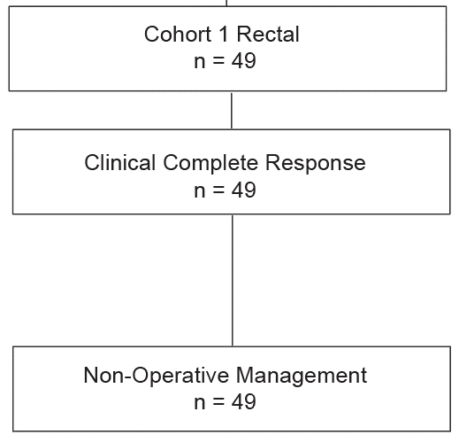
Cohort 1 – Rectal Cancers – Response and Surgical Management
Slides courtesy of Andrea Cercek, MD
Cercek, Diaz NEJM 2025
Notes:
Updated MBF

Slide 28
Cohort 1 – Rectal Cancers – Response and Surgical Management
Slides courtesy of Andrea Cercek, MD
Cercek, Diaz NEJM 2025
Notes:
Updated MBF

Slide 29
Cohort 1 – Rectal Cancers – Response and Surgical Management
Slides courtesy of Andrea Cercek, MD
Cercek, Diaz NEJM 2025
Notes:
Updated MBF

Slide 30
Cohort 1 – Rectal Cancers – Response and Surgical Management
Rectal cancers achieved 100% clinical complete responses
Slides courtesy of Andrea Cercek, MD
Cercek, Diaz NEJM 2025
Notes:
Updated MBF

Slide 31
Cohort 1 – Rectal Cancers – Durability of Response n=50
Rectal Swimmers
Median Follow-up for Recurrence
% Recurrence-free at 2-years
Median Follow-up for Recurrence
30.2 months (Range 5.8-60.8 months)
96% Recurrence-free at 2-years
5-years
Slides courtesy of Andrea Cercek, MD
Cercek, Diaz NEJM 2025
Notes:
Updated MBF

Slide 32
AZUR-1: A Phase 2 Study of Dostarlimab in Patients With Untreated dMMR/​MSI-H Locally Advanced Rectal Cancer
Study design^{1,2}
Key Eligibility Criteria
Adults ≥18 years old
Histologically confirmed Stage II to III (T3-T4, N0, or T any, N+), locally advanced rectal cancer
Radiologically and endoscopically evaluable disease
Tumor which can be categorized as dMMR or MSI-H by local or central assessment
− cCR
@ EOT
SOC ± surgery
N=154
Dostarlimab
(IV; Q3W x 9 cycles)
NOM
+ cCR
@ EOT
Primary endpoint:
Proportion who sustain cCR for 12 months (cCR12) by ICR
Secondary endpoints:
Organ preservation rate
OS (overall and 5-year)
ORR by ICR and INV
Safety (AE, AELD, SAE, irAE)
PK parameters
cCR24 and cCR36 by ICR
cCR12 by INV
3-year EFS by INV
DSS (overall and 5-year)
Slides courtesy of Andrea Cercek, MD

Slide 33
Colon Cancer: Mismatch repair deficient (dMMR/MSI)
About 10-15% of all early stage colon tumors
Standard treatment includes resection + adjuvant chemotherapy
Tumor agnostic approval for ICB MMRd solid tumors in advanced disease
Slides courtesy of Andrea Cercek, MD
Le, et al NEJM 2015

Slide 34
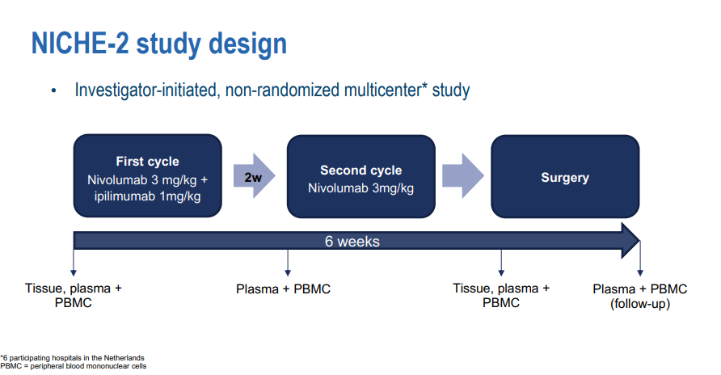
Chalabi M, et al. ESMO 2022
Slides courtesy of Andrea Cercek, MD

Slide 35
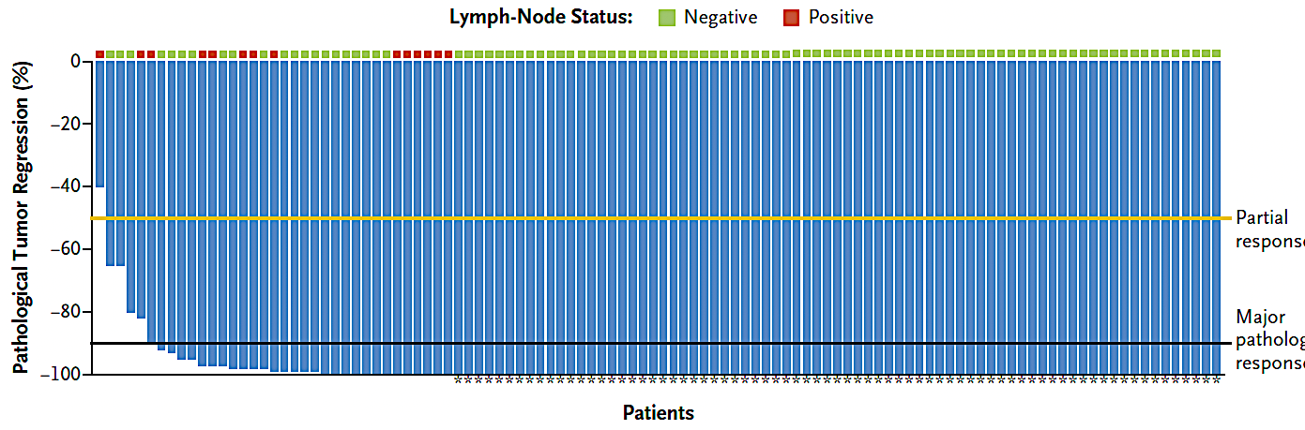
NICHE 2: Results
68% pCR
Slides courtesy of Andrea Cercek, MD
Chalabi NEJM 2024

Slide 36
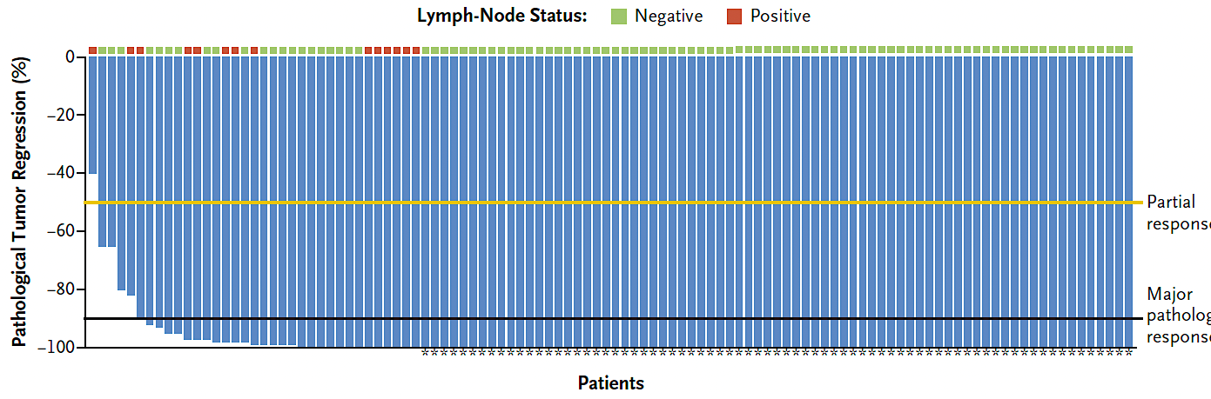
NICHE 2: Results
68% pCR
AEs: Grade 3 or 4 events in 5 patients
Slides courtesy of Andrea Cercek, MD
Chalabi NEJM 2024

Slide 37
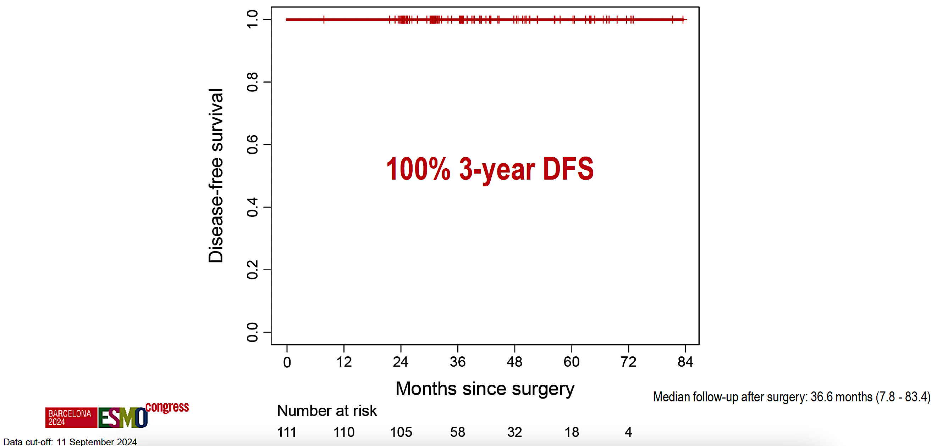
NICHE-2: Results
Slides courtesy of Andrea Cercek, MD
Chalabi ESMO 2024

Slide 38
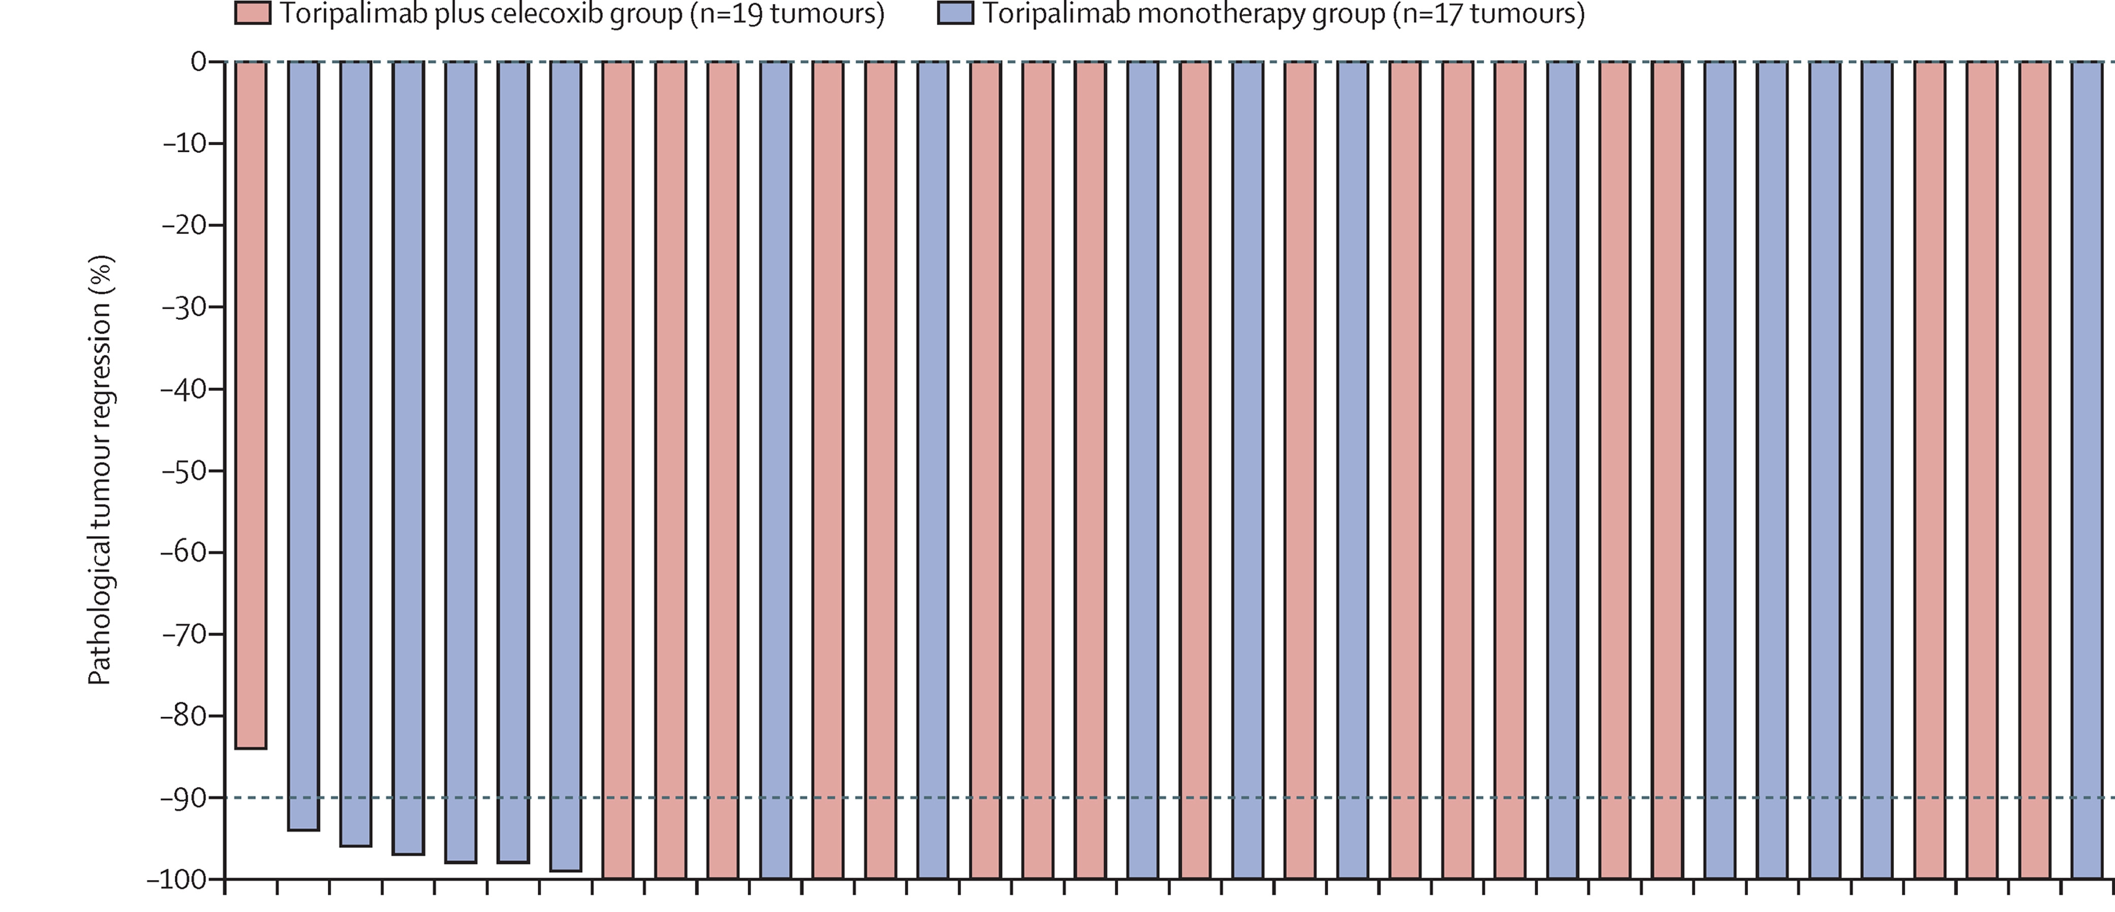
Neoadjuvant PD-1 blockade with toripalimab, with or without celecoxib, in mismatch repair-deficient or microsatellite instability-high, locally advanced, colorectal cancer (PICC): a single-centre, parallel-group, non-comparative, randomised, phase 2 trial
Treatment: Toripalimab (anti PD1) for 3 months with or without celecoxib
Hu et al, The Lancet Gastroenterology and Hepatology 2021
Slides courtesy of Andrea Cercek, MD
Notes:
Background
PD-1 blockade is highly effective in patients with mismatch repair-deficient or microsatellite instability-high metastatic colorectal cancer. The role of single-agent PD-1 blockade in the neoadjuvant setting for resectable mismatch repair-deficient or microsatellite instability-high colorectal cancer remains unclear. We investigated the efficacy and safety of PD-1 blockade with toripalimab, with or without the COX-2 inhibitor celecoxib, as neoadjuvant treatment for mismatch repair-deficient or microsatellite instability-high, locally advanced, colorectal cancers.
Methods
The PD-1 Inhibitor in Microsatellite Instability Colorectal Cancer (PICC) trial was a single-centre, open-label, parallel-group, non-comparative, randomised, phase 2 study undertaken at the Sixth Affiliated Hospital of Sun Yat-sen University (Guangzhou, China). Eligible patients were aged 18–75 years, had histologically confirmed mismatch repair-deficient or microsatellite instability-high colorectal cancer, had clinical stage T3–T4 or any T with lymph node positivity (N+), Eastern Cooperative Oncology Group performance score of 0 or 1, and adequate haematological, hepatic, and renal function. Participants were randomly assigned (1:1), without any stratification or balanced blocking, to receive toripalimab 3 mg/kg intravenously on day 1, with or without celecoxib 200 mg orally twice daily from day 1 to 14 of each 14-day cycle, for six cycles before surgical resection. Adjuvant treatment with toripalimab with or without celecoxib was permitted at the investigators' discretion. The primary endpoint was the proportion of patients with pathological complete response, defined as tumours without any viable tumour cells in the resected primary tumour sample and all sampled regional lymph nodes. All efficacy and safety analyses were assessed in the modified intention-to-treat population, which included all patients who were randomly assigned to treatment and who received at least one dose of toripalimab. This trial is registered with ClinicalTrials.gov, NCT03926338, and is ongoing.
Findings
Between May 1, 2019, and April 1, 2021, 53 patients were screened, of whom 34 were randomly assigned to either the toripalimab plus celecoxib group (n=17) or the toripalimab monotherapy group (n=17). As of data cutoff (Aug 10, 2021), median follow-up was 14·9 months (IQR 8·8–17·0). All patients received study treatment and underwent surgical resection; there were no treatment-related surgical delays. All 34 patients had an R0 resection (>1 mm resection margin). 15 of 17 patients (88% [95% CI 64–99]) in the toripalimab plus celecoxib group and 11 of 17 patients (65% [38–86]) in the toripalimab monotherapy group had a pathological complete response. All patients continued to receive adjuvant toripalimab with or without celecoxib for a total perioperative duration of 6 months and were alive and free of recurrence at data cutoff. During neoadjuvant treatment, ten (59%) patients in the toripalimab plus celecoxib group and ten (59%) in the toripalimab monotherapy group had grade 1–2 treatment-related adverse events. Only one (3%) of 34 patients, who was in the toripalimab plus celecoxib group, had a grade 3 or higher treatment-related adverse event during the neoadjuvant phase, which was grade 3 increased aspartate aminotransferase levels. In the adjuvant phase, only one (3%) of 34 patients, who was in the toripalimab monotherapy group, had a grade 3 or higher treatment-related adverse events, which was grade 3 increased aspartate aminotransferase and alanine aminotransferase levels.
Interpretation
Neoadjuvant toripalimab with or without celecoxib could be a potential therapeutic option for patients with mismatch repair deficient or microsatellite instability-high, locally advanced, colorectal cancer. This treatment was associated with a high pathological complete response rate and an acceptable safety profile, which did not compromise surgery. Longer term follow-up is needed to assess effects on survival-related endpoints.

Slide 39
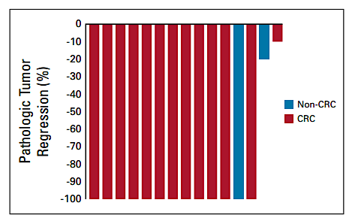
Phase II study of neoadjuvant pembrolizumab in localized unresectable MSI solid tumors
Included 19 MSI colon cancer patients
17 underwent surgery
pCR 65%
Ludford et al JCO 2023
Slides courtesy of Andrea Cercek, MD
Notes:
Background
PD-1 blockade is highly effective in patients with mismatch repair-deficient or microsatellite instability-high metastatic colorectal cancer. The role of single-agent PD-1 blockade in the neoadjuvant setting for resectable mismatch repair-deficient or microsatellite instability-high colorectal cancer remains unclear. We investigated the efficacy and safety of PD-1 blockade with toripalimab, with or without the COX-2 inhibitor celecoxib, as neoadjuvant treatment for mismatch repair-deficient or microsatellite instability-high, locally advanced, colorectal cancers.
Methods
The PD-1 Inhibitor in Microsatellite Instability Colorectal Cancer (PICC) trial was a single-centre, open-label, parallel-group, non-comparative, randomised, phase 2 study undertaken at the Sixth Affiliated Hospital of Sun Yat-sen University (Guangzhou, China). Eligible patients were aged 18–75 years, had histologically confirmed mismatch repair-deficient or microsatellite instability-high colorectal cancer, had clinical stage T3–T4 or any T with lymph node positivity (N+), Eastern Cooperative Oncology Group performance score of 0 or 1, and adequate haematological, hepatic, and renal function. Participants were randomly assigned (1:1), without any stratification or balanced blocking, to receive toripalimab 3 mg/kg intravenously on day 1, with or without celecoxib 200 mg orally twice daily from day 1 to 14 of each 14-day cycle, for six cycles before surgical resection. Adjuvant treatment with toripalimab with or without celecoxib was permitted at the investigators' discretion. The primary endpoint was the proportion of patients with pathological complete response, defined as tumours without any viable tumour cells in the resected primary tumour sample and all sampled regional lymph nodes. All efficacy and safety analyses were assessed in the modified intention-to-treat population, which included all patients who were randomly assigned to treatment and who received at least one dose of toripalimab. This trial is registered with ClinicalTrials.gov, NCT03926338, and is ongoing.
Findings
Between May 1, 2019, and April 1, 2021, 53 patients were screened, of whom 34 were randomly assigned to either the toripalimab plus celecoxib group (n=17) or the toripalimab monotherapy group (n=17). As of data cutoff (Aug 10, 2021), median follow-up was 14·9 months (IQR 8·8–17·0). All patients received study treatment and underwent surgical resection; there were no treatment-related surgical delays. All 34 patients had an R0 resection (>1 mm resection margin). 15 of 17 patients (88% [95% CI 64–99]) in the toripalimab plus celecoxib group and 11 of 17 patients (65% [38–86]) in the toripalimab monotherapy group had a pathological complete response. All patients continued to receive adjuvant toripalimab with or without celecoxib for a total perioperative duration of 6 months and were alive and free of recurrence at data cutoff. During neoadjuvant treatment, ten (59%) patients in the toripalimab plus celecoxib group and ten (59%) in the toripalimab monotherapy group had grade 1–2 treatment-related adverse events. Only one (3%) of 34 patients, who was in the toripalimab plus celecoxib group, had a grade 3 or higher treatment-related adverse event during the neoadjuvant phase, which was grade 3 increased aspartate aminotransferase levels. In the adjuvant phase, only one (3%) of 34 patients, who was in the toripalimab monotherapy group, had a grade 3 or higher treatment-related adverse events, which was grade 3 increased aspartate aminotransferase and alanine aminotransferase levels.
Interpretation
Neoadjuvant toripalimab with or without celecoxib could be a potential therapeutic option for patients with mismatch repair deficient or microsatellite instability-high, locally advanced, colorectal cancer. This treatment was associated with a high pathological complete response rate and an acceptable safety profile, which did not compromise surgery. Longer term follow-up is needed to assess effects on survival-related endpoints.

Slide 40
AZUR-2: A Phase 3 Study of Perioperative Dostarlimab in Patients With Untreated T4N0 or Stage III dMMR/​MSI-H Resectable Colon Cancer
Study design^{1,2}
Key Eligibility Criteria
Adults ≥18 years old
Untreated pathologically confirmed colon adenocarcinoma
Resectable colon adenocarcinoma defined as clinically T4N0 or Stage III
Radiologically evaluable disease
Tumour demonstrating either dMMR or MSI-H status
Dostarlimab
(IV; Q3W x 4 cycles)
Surgery
Dostarlimab
(IV; Q6W x 6 cycles)
N=711
R
(2:1)
Surgery
SOC (adjuvant FOLFOX/CAPEOX for
3–6 months or WW)
Primary endpoint:
EFS up to 5 years
(BICR)
Secondary endpoints:
OS
Participants with
pathological response
EFS (by LA)
Participants with treatment-emergent AEs, SAEs, imAEs, AEs leading to death or discontinuation
PK parameters
Participants with anti-drug antibodies
Slides courtesy of Andrea Cercek, MD

Slide 41
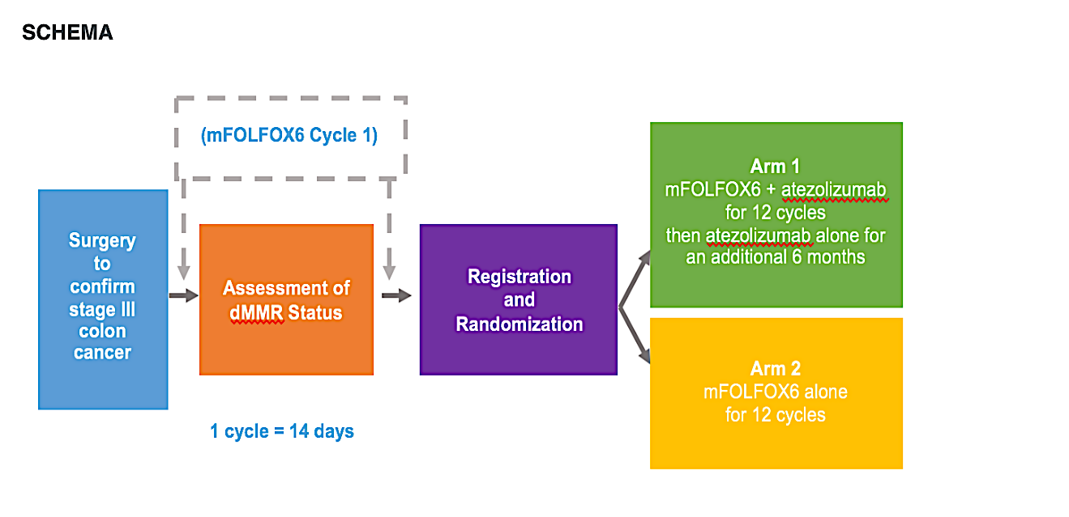
ATOMIC: Randomized study of adjuvant FOLFOX +/- Atezolizumab for MMRd Stage III colon cancer
Sinicrope et al, NEJM 2026
Slides courtesy of Andrea Cercek, MD

Slide 42
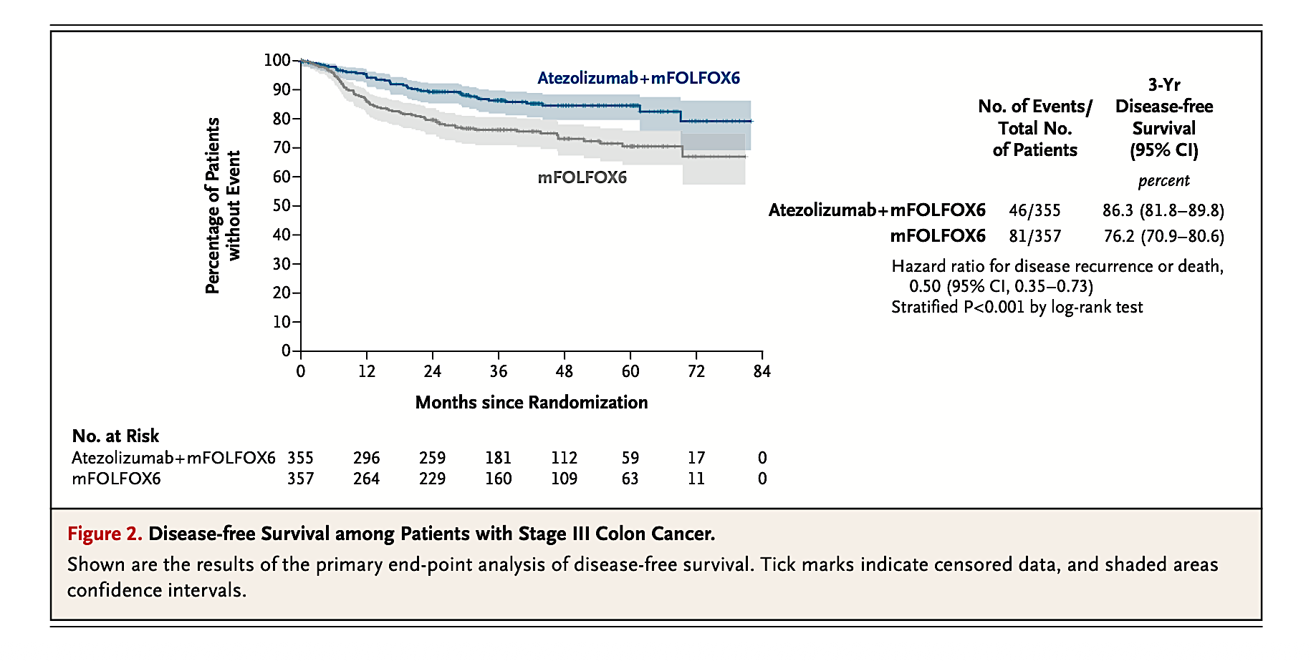
ATOMIC: Randomized study of adjuvant FOLFOX +/- Atezolizumab for MMRd Stage III colon cancer
Sinicrope et al, NEJM 2026
Slides courtesy of Andrea Cercek, MD

Slide 43
MMRd Colon: Possibility of Nonoperative Management
Could non-operative management of MMRd tumors extend beyond rectal cancer?
1. Clinical complete response → Non operative management
2. Durability of clinical complete response
3. Understand incomplete responses and recurrences
Slides courtesy of Andrea Cercek, MD

Slide 44
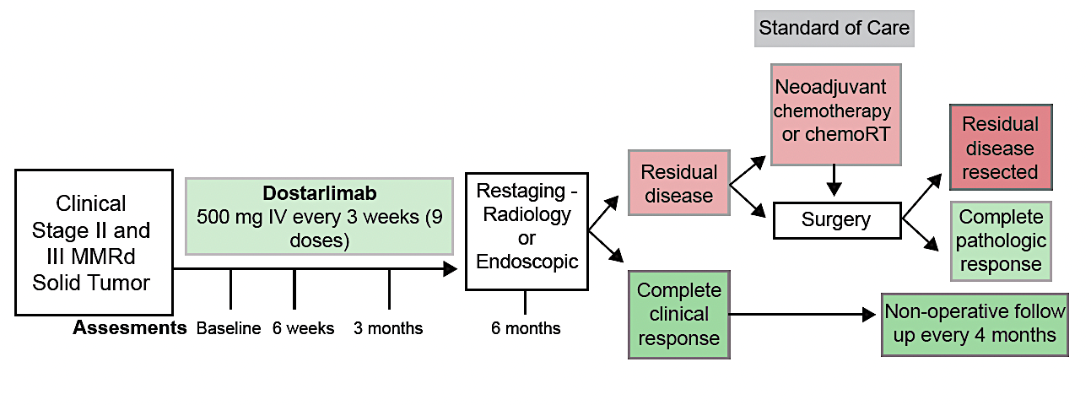
Neoadjuvant PD-1 blockade in locally advanced MMRd solid tumors
NCT 04165772
Stage I-III
MMRd by IHC
Assessments
Slides courtesy of Andrea Cercek, MD
Cercek, Diaz NEJM 2025

Slide 45
Patient Characteristics
Slides courtesy of Andrea Cercek, MD
Cercek, Diaz NEJM 2025

Slide 46
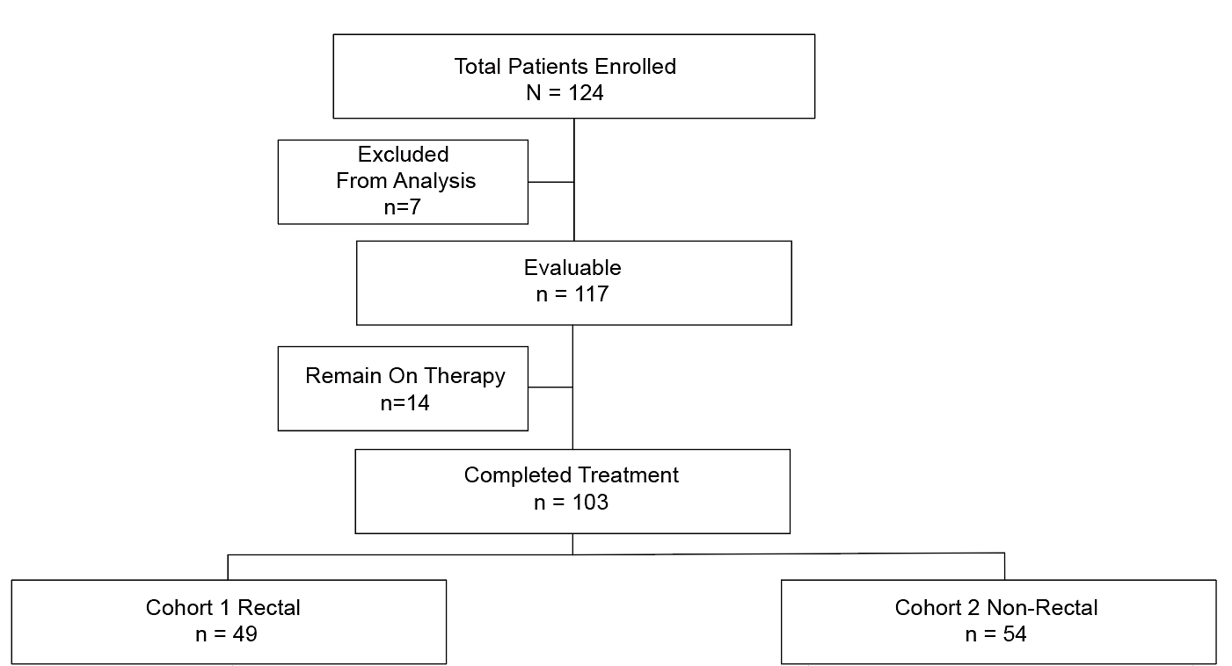
Study Flow Diagram
Slides courtesy of Andrea Cercek, MD
Cercek, Diaz NEJM 2025
Notes:
Updated MBF

Slide 47
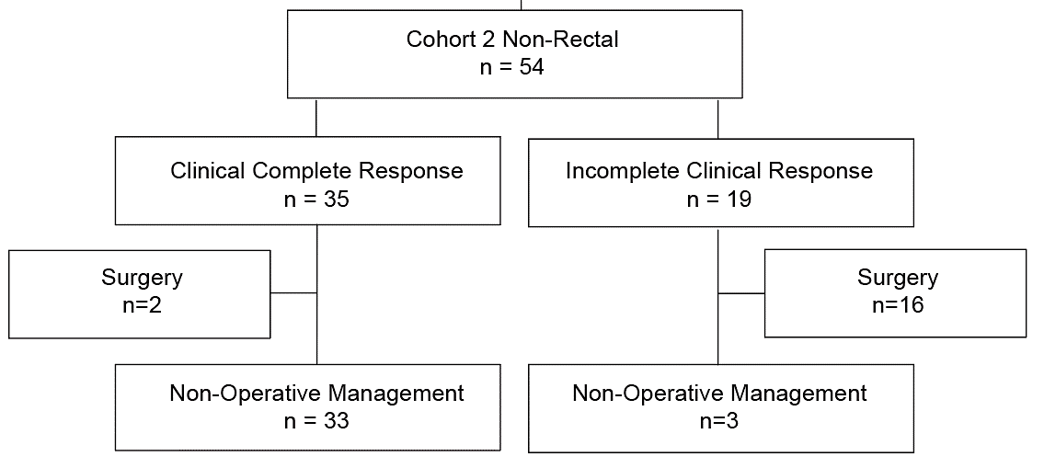
Cohort 2 – Non-rectal cancer – Responses and Surgical Management
Slides courtesy of Andrea Cercek, MD
Cercek, Diaz NEJM 2025
Notes:
Updated MBF

Slide 48
Cohort 2 – Non-rectal cancer – Responses and Surgical Management
Slides courtesy of Andrea Cercek, MD
Cercek, Diaz NEJM 2025
Notes:
Updated MBF

Slide 49
Cohort 2 – Non-rectal cancer – Responses and Surgical Management
Slides courtesy of Andrea Cercek, MD
Cercek, Diaz NEJM 2025
Notes:
Updated MBF

Slide 50
Cohort 2 – Non-rectal cancer – Responses and Surgical Management
Slides courtesy of Andrea Cercek, MD
Cercek, Diaz NEJM 2025
Notes:
Updated MBF

Slide 51
Cohort 2 – Non-rectal cancer – Responses and Surgical Management
Colon: 82% achieved a clinical complete response
Slides courtesy of Andrea Cercek, MD
Cercek, Diaz NEJM 2025
Notes:
Updated MBF

Slide 52
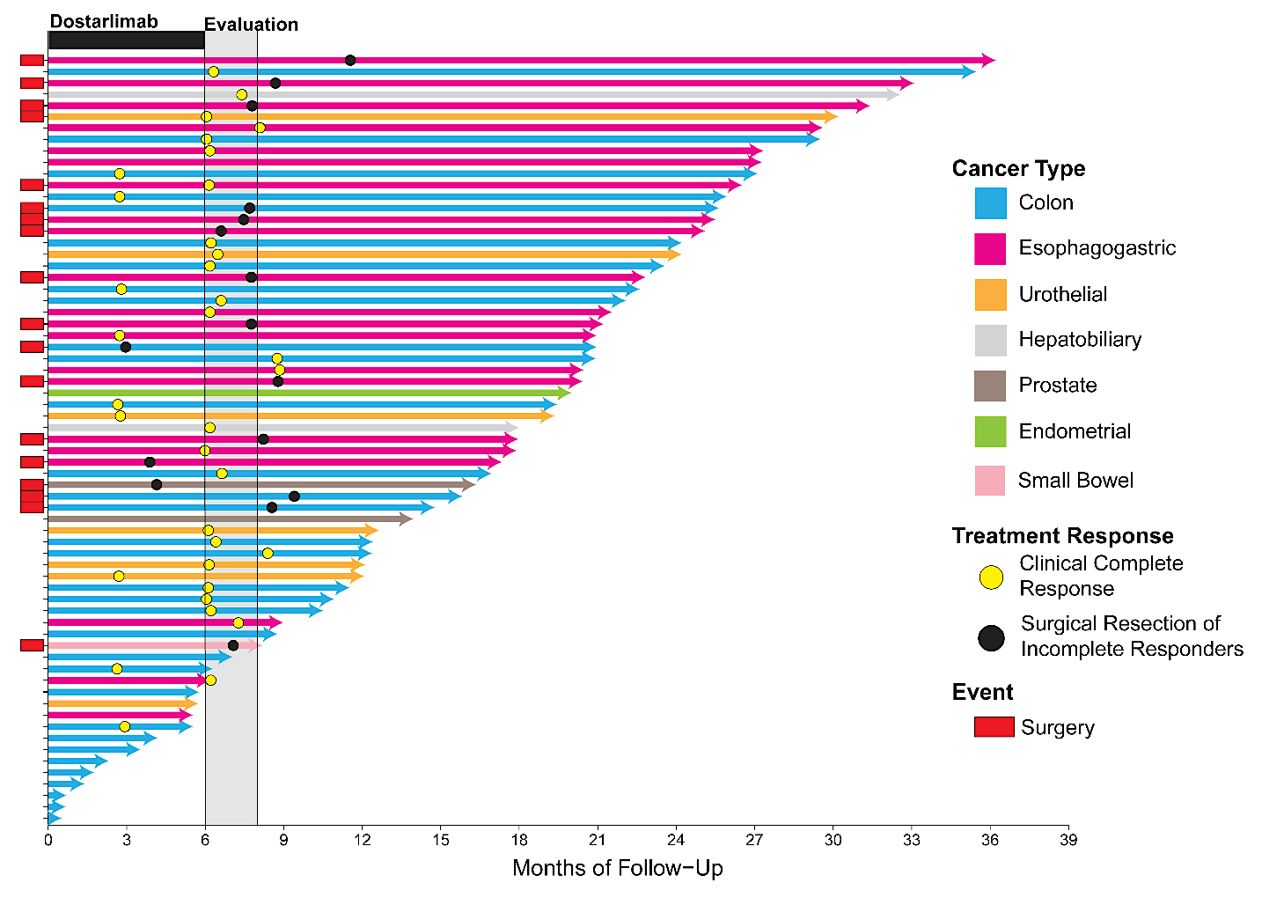
Cohort 2 – Non-rectal cancer – Durability of response n=67
Median Follow-up for Recurrence 14.9 months (range 0-32.7 months)
85% Recurrence-free at 2-years
Non - Rectal Swimmers
Median Follow-up for Recurrence
% Recurrence-free at 2-years
Median Follow-up for Recurrence
14.9 months (Range 0-32.7 months)
85% Recurrence-free at 2-years
Slides courtesy of Andrea Cercek, MD
Cercek, Diaz NEJM 2025
Notes:
Updated MBF

Slide 53
Neoadjuvant Immunotherapy in MSI-H Colon Cancer
Significant tumor regression, 67-75% complete pathologic response
Duration of immunotherapy was variable 1-6 mo
Slides courtesy of Andrea Cercek, MD

Slide 54
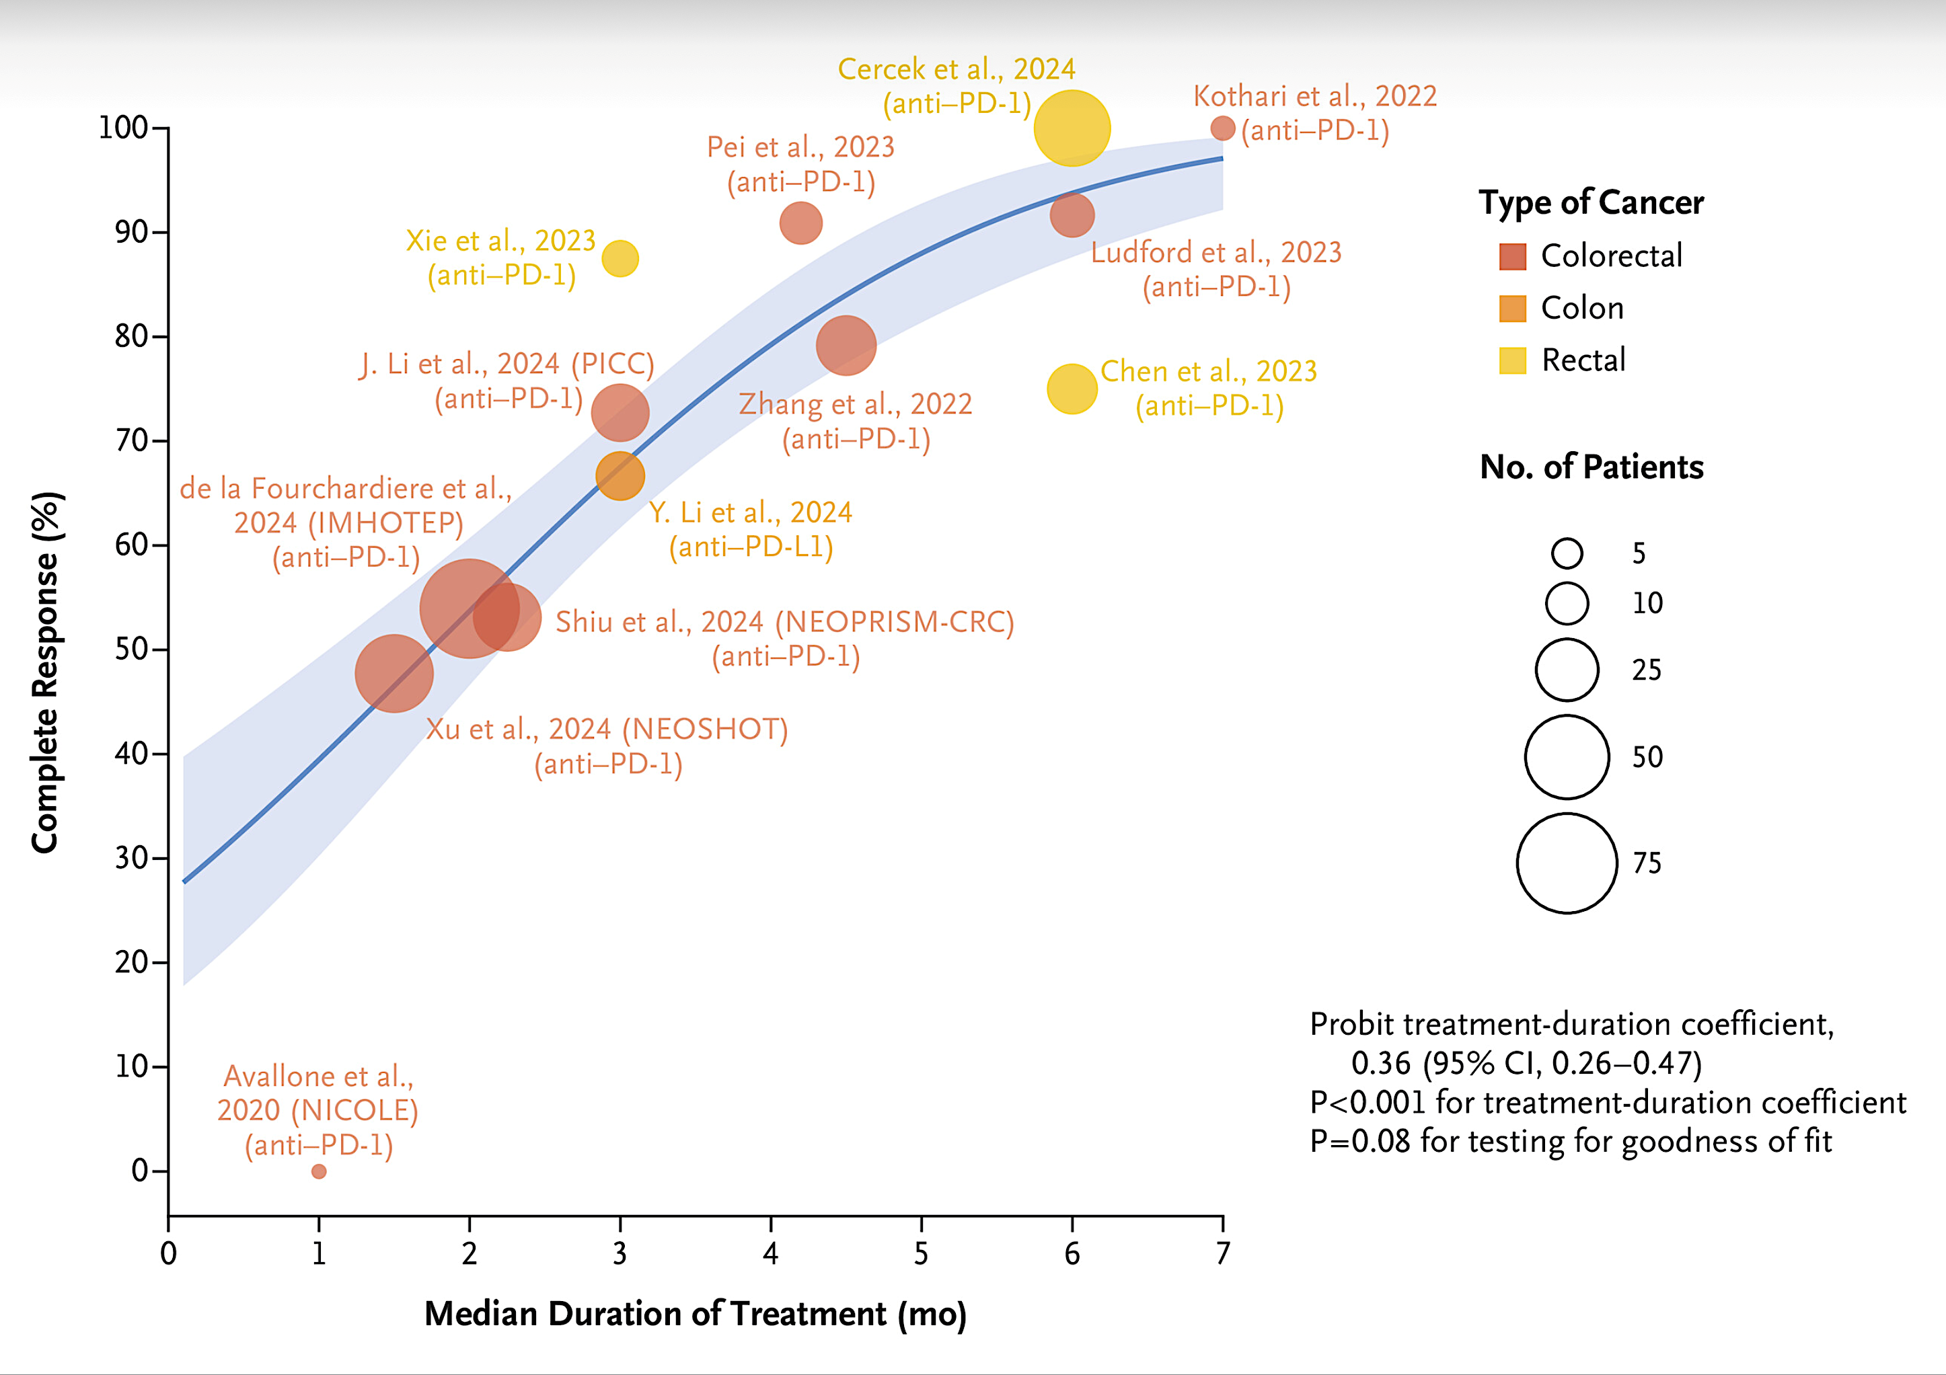
Duration of Neoadjuvant Immunotherapy and Incidence of Complete Response among Patients with MMRd Colorectal Cancer
Slides courtesy of Andrea Cercek, MD
Rousseau, White, Cercek, Diaz NEJM 2025

Slide 55
Assessment of clinical complete response
The large majority of early stage locally advanced solid MMRd tumors are very sensitive to ICB and response is rapid
Although protocol is 6 months…
  IF the tumor is responding, patience and close follow up is key
  Unknown if it is just time or if ICB should be continued
  Endoscopic exams and biopsies to ensure tumor is MMRd, residual disease can be MMRp
  Assessment of cCR outside the rectum is challenging
Slides courtesy of Andrea Cercek, MD

Slide 56
Conclusions and future directions
Further work in markers of cCR is warranted
Neoadjuvant PD-1 blockade in MMRd tumors could obliviate the need for standard of care chemotherapy, radiation and surgery in 2-3% of all early -stage cancer cases
ctDNA appears to be a promising marker of complete response
Some MMRd solid tumors may require longer duration or combination ICB to achieve a clinical complete response
Evaluation of response and resistance
Andrea Cercek, MD
Slides courtesy of Andrea Cercek, MD

Slide 57
Which testing method do you generally use to assess MSI/MMR status in localized colorectal cancer (CRC)?
Tissue testing
Tissue testing
Tissue testing
Tissue testing
Tissue testing
Tissue testing

Slide 58
In general, which assay(s) do you employ to assess MSI/MMR status in localized CRC?
Both IHC and NGS
Mainly NGS, ideally would like to do both IHC and NGS
IHC
Both IHC and NGS
IHC
Both IHC and NGS
IHC = immunohistochemistry; NGS = next-generation sequencing

Slide 59
Faculty Discussion
Which testing method do you generally use to assess MSI/MMR status in localized colorectal cancer (CRC)?
In general, which assay(s) do you employ to assess MSI/MMR status in localized CRC?

Slide 60
Regulatory and reimbursement issues aside, what would you most likely recommend as neoadjuvant therapy for a 65-year-old patient with MSI-high (MSI-H)/MMR-deficient (dMMR) locally advanced rectal cancer?
Dostarlimab or pembrolizumab
Dostarlimab
Dostarlimab
Dostarlimab
Pembrolizumab
Dostarlimab

Slide 61
In which clinical situations are you currently administering an immune checkpoint inhibitor as a component of neoadjuvant therapy for a patient with MSI-H/dMMR early-stage rectal cancer?
Pretty much everyone and more as a NOM strategy
Preferably for any patient with localized rectal cancer who does not have a contraindication to immunotherapy
Any patient being considered for neoadjuvant therapy
All cases unless the patient has an autoimmune disease
that is prohibitive of IO therapy
For any patient eligible for neoadjuvant therapy without contraindications to immune-checkpoint therapy
Stage II and III
NOM = nonoperative management

Slide 62
Regulatory and reimbursement issues aside, what would you most likely recommend as neoadjuvant therapy for a 65-year-old patient with MSI-H/dMMR locally advanced colon cancer?
None
Nivolumab/ipilimumab
None
Nivolumab/ipilimumab
Pembrolizumab
Nivolumab/ipilimumab

Slide 63
Faculty Discussion
Regulatory and reimbursement issues aside, what would you most likely recommend as neoadjuvant therapy for a 65-year-old patient with MSI-H/dMMR locally advanced rectal cancer?
In which clinical situations are you currently administering an immune checkpoint inhibitor as a component of neoadjuvant therapy for a patient with MSI-H/dMMR early-stage rectal cancer?
Regulatory and reimbursement issues aside, what would you most likely recommend as neoadjuvant therapy for a 65-year-old patient with MSI-H/dMMR locally advanced colon cancer?

Slide 64
Regulatory and reimbursement issues aside, what would you most likely recommend for a 65-year-old patient with MSI-H/dMMR Stage III rectal cancer who receives 6 months of neoadjuvant dostarlimab and achieves a complete clinical response?
Observation
Surgical resection followed by observation
Observation
Observation
Observation
Surgical resection followed by observation

Slide 65
Regulatory and reimbursement issues aside, what would you most likely recommend for a 65-year-old patient with MSI-H/dMMR Stage III rectal cancer who receives 6 months of neoadjuvant dostarlimab and does not achieve a complete clinical response?
Surgical resection followed by adjuvant chemotherapy
Continue immunotherapy as long as there is some response even if not a full cCR; If no response or progression, then surgery
Discussion on chemoradiation followed by surgery
Surgical resection followed by observation
Surgical resection followed by observation
Surgical resection followed by observation
cCR = complete clinical response

Slide 66
A 65-year-old patient presents with high-risk Stage II MSI-H/dMMR colon cancer and undergoes R0 resection. Regulatory and reimbursement issues aside, what would be your preferred approach to adjuvant therapy?
Atezolizumab +/- CAPOX (3 months)
For many, would observe; for those with T4, would discuss option FOLFOX/CAPOX + atezolizumab
Observation unless MRD+ and/or T4b tumor
Observation
FOLFOX/CAPOX + atezolizumab
FOLFOX/CAPOX + atezolizumab
MRD = molecular residual disease

Slide 67
A 65-year-old patient presents with Stage III MSI-H/dMMR colon cancer and undergoes R0 resection. Regulatory and reimbursement issues aside, what would be your preferred approach to adjuvant therapy?
Atezolizumab +/- CAPOX (3 months)
FOLFOX/CAPOX + atezolizumab
FOLFOX/CAPOX + atezolizumab
FOLFOX/CAPOX + atezolizumab or pembrolizumab monotherapy
FOLFOX/CAPOX + atezolizumab
FOLFOX/CAPOX + atezolizumab

Slide 68
Faculty Discussion
Regulatory and reimbursement issues aside, what would you most likely recommend for a 65-year-old patient with MSI-H/dMMR Stage III rectal cancer who receives 6 months of neoadjuvant dostarlimab and achieves a complete clinical response?
Regulatory and reimbursement issues aside, what would you most likely recommend for a 65-year-old patient with MSI-H/dMMR Stage III rectal cancer who receives 6 months of neoadjuvant dostarlimab and does not achieve a complete clinical response?
A 65-year-old patient presents with high-risk Stage II MSI-H/dMMR colon cancer and undergoes R0 resection. Regulatory and reimbursement issues aside, what would be your preferred approach to adjuvant therapy?
A 65-year-old patient presents with Stage III MSI-H/dMMR colon cancer and undergoes R0 resection. Regulatory and reimbursement issues aside, what would be your preferred approach to adjuvant therapy?

Slide 69
Agenda
Module 1: Current and Future Role of Immune Checkpoint Inhibition in the Management of Microsatellite Instability-High (MSI-H)/Mismatch Repair Deficient (dMMR) Localized and Locally Advanced Colorectal Cancer (CRC) — Dr Cohen
Module 2: Clinical Relevance and Practical Utilization of Molecular Residual Disease (MRD) Analysis in CRC — Dr Dasari
Module 3: Recent Advances in Metastatic CRC (mCRC): Optimizing Immunotherapy and Other Approaches — Dr Bekaii-Saab

Slide 70
Clinical Relevance and Practical Utilization of Molecular Residual Disease (MRD) Analysis in CRC
Arvind Dasari, MD, MS
Professor
Department of Gastrointestinal Medical Oncology
The University of Texas MD Anderson Cancer Center
Houston, Texas

Slide 71
Key Takeaway Points
MRD assays available for clinical use in the United States and approved by CMS
Clinical validity established by observational studies; prospective clinical utility studies are ongoing
Unique opportunity to integrate research & clinical practice for efficient and rapid generation of missing data

Slide 72
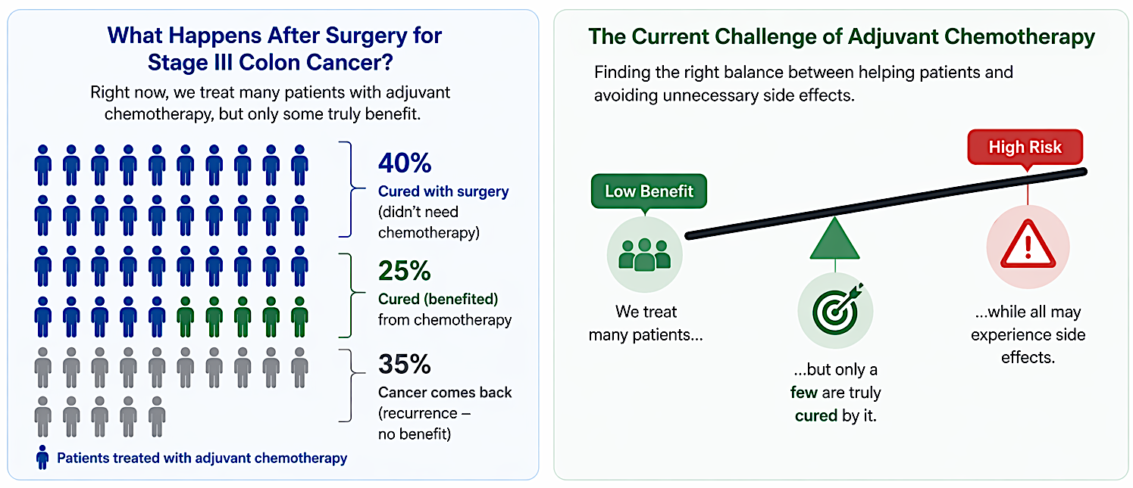
Adjuvant Therapy for Colon Cancer

Slide 73
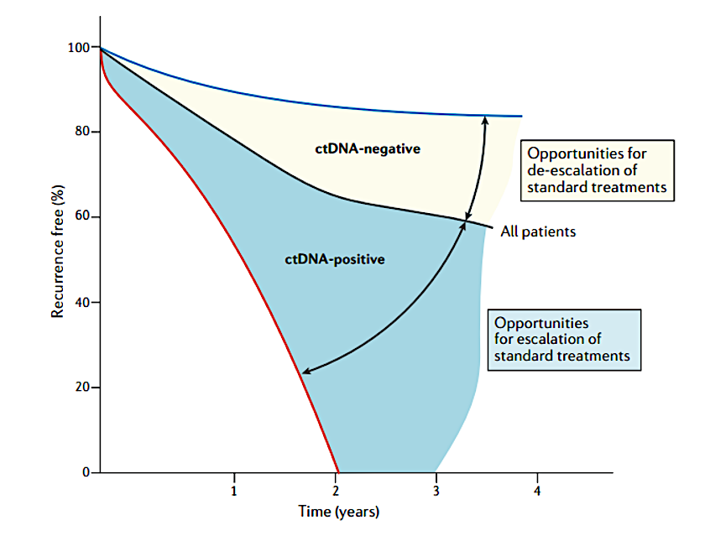
MRD For Adjuvant Therapy Decisions
Dasari et al, Nat Rev Clin Oncol. 2020

Slide 74
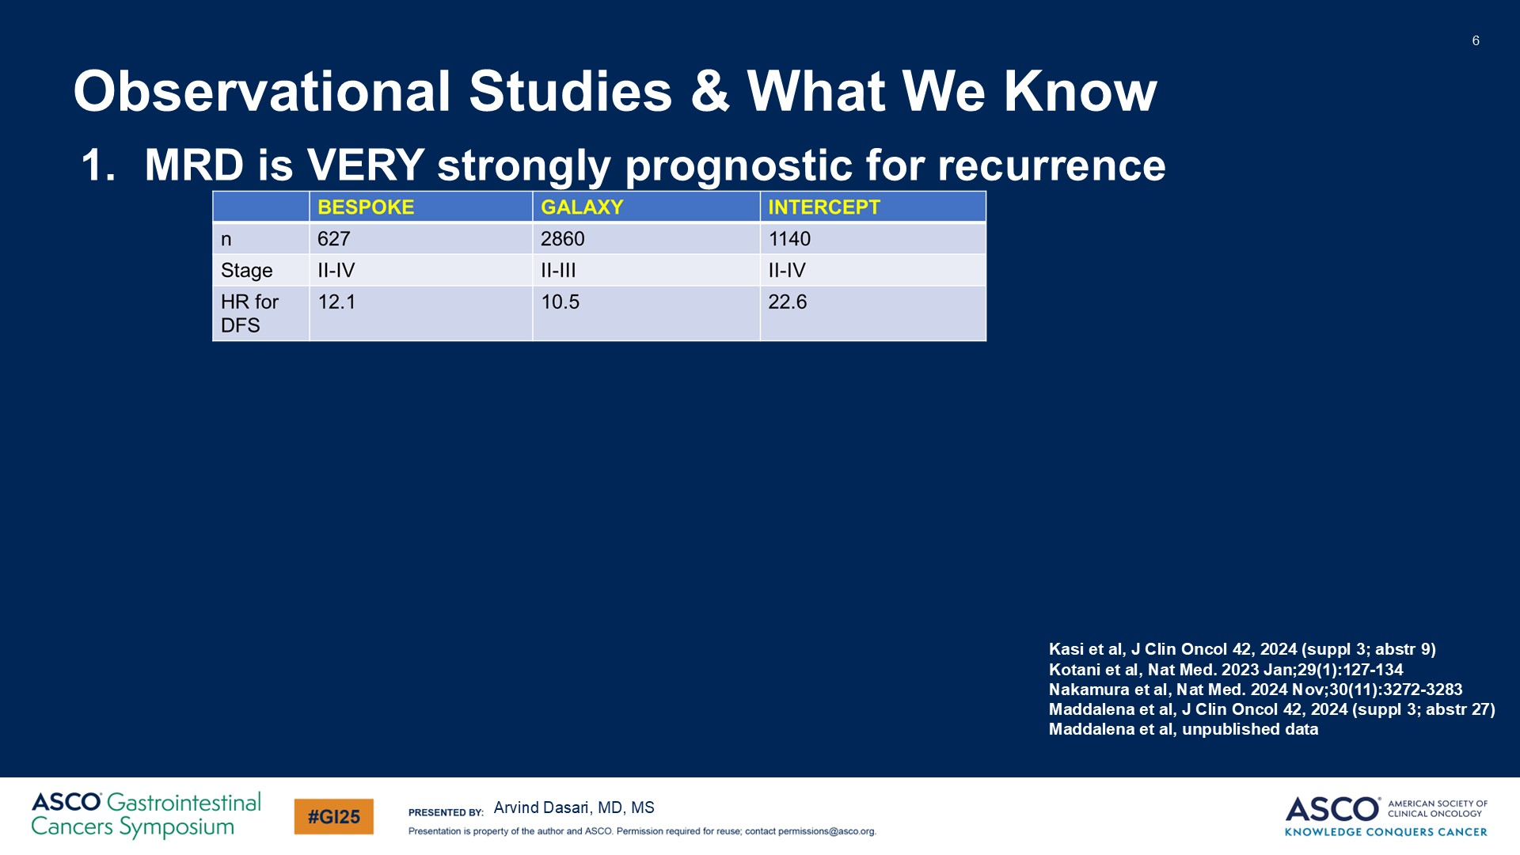
Observational Studies & What We Know
Dasari A et al. ASCO GI 2025

Slide 75
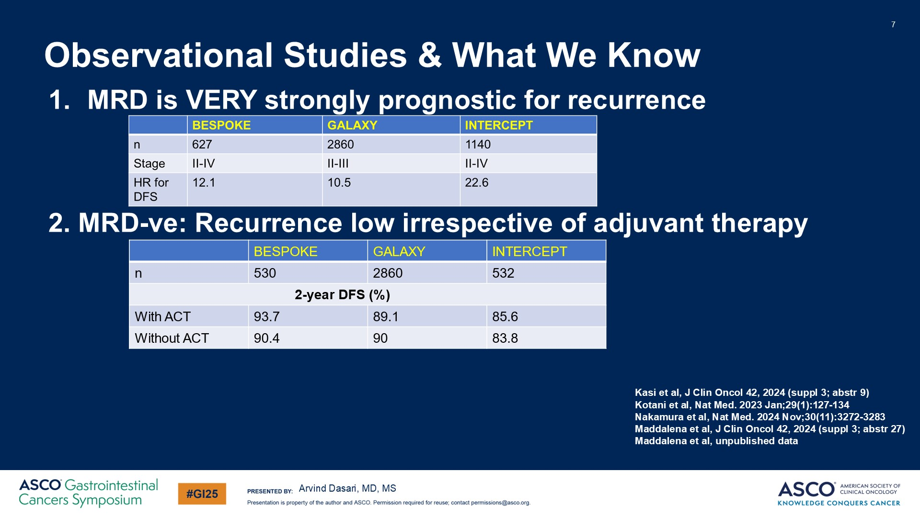
Observational Studies & What We Know
Dasari A et al. ASCO GI 2025

Slide 76
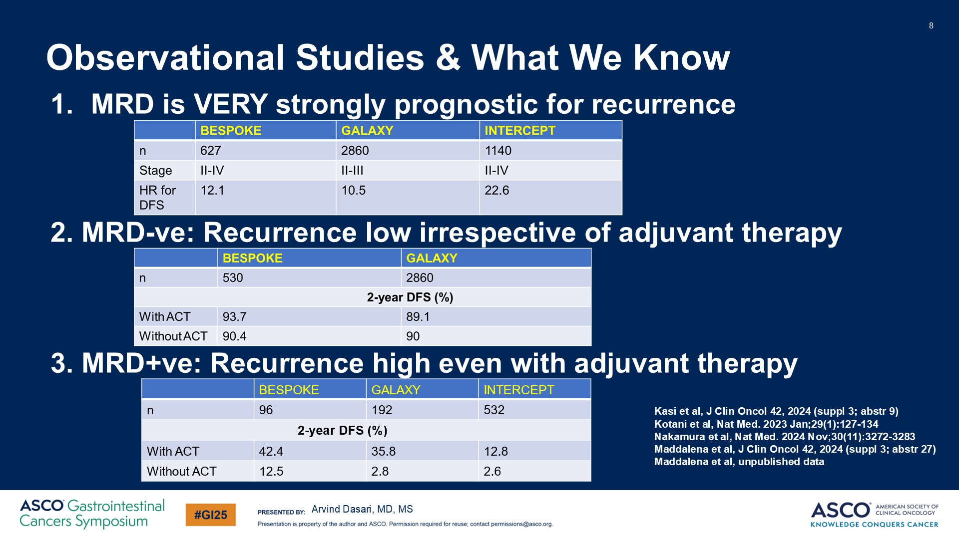
Observational Studies & What We Know
Dasari A et al. ASCO GI 2025

Slide 77
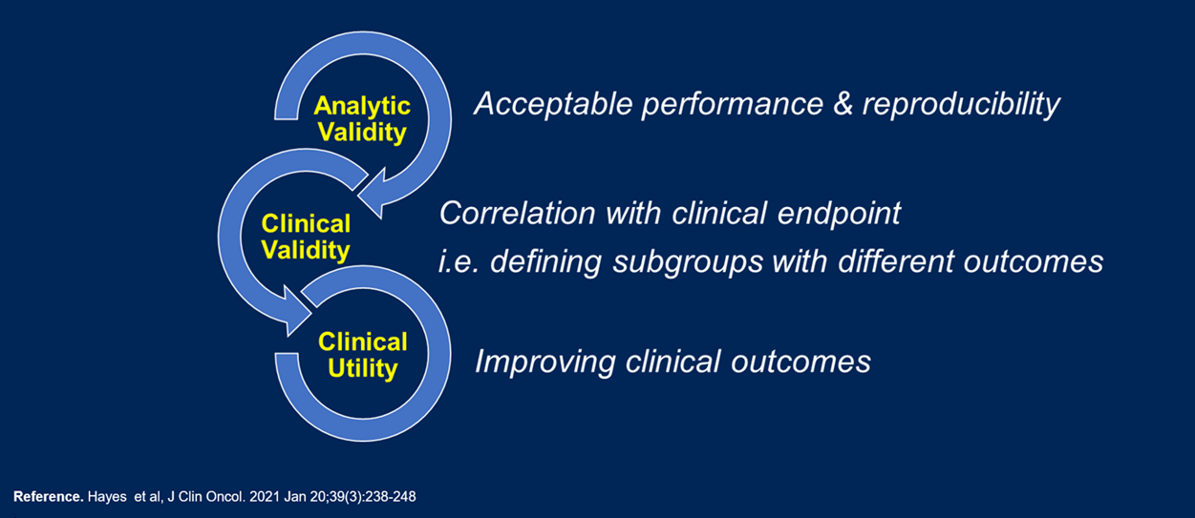

Where Are We Today ?
MRD in CRC
Arvind Dasari, MD, MS

Slide 78
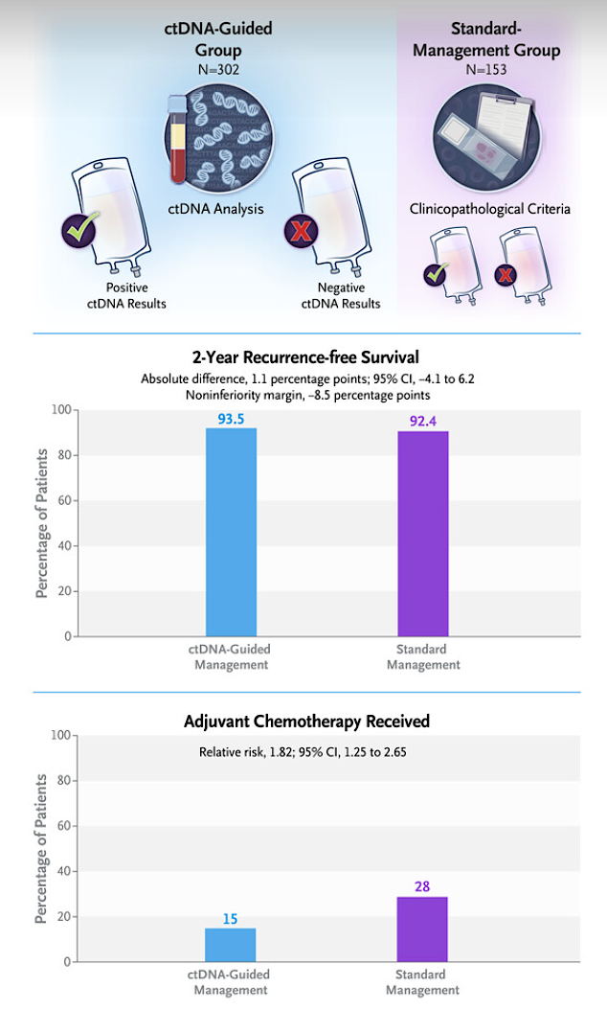
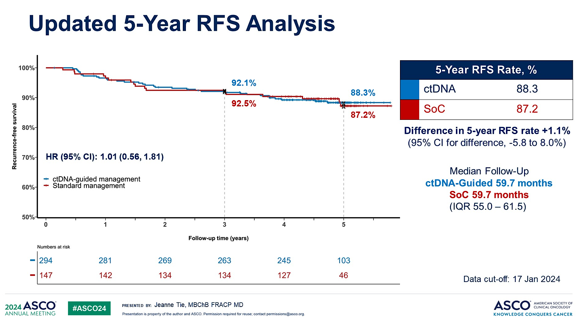
Completed Randomized Trials: DYNAMIC II
Tie et al, N Engl J Med. 2022 Jun 16;386(24):2261-2272
Arvind Dasari, MD, MS

Slide 79
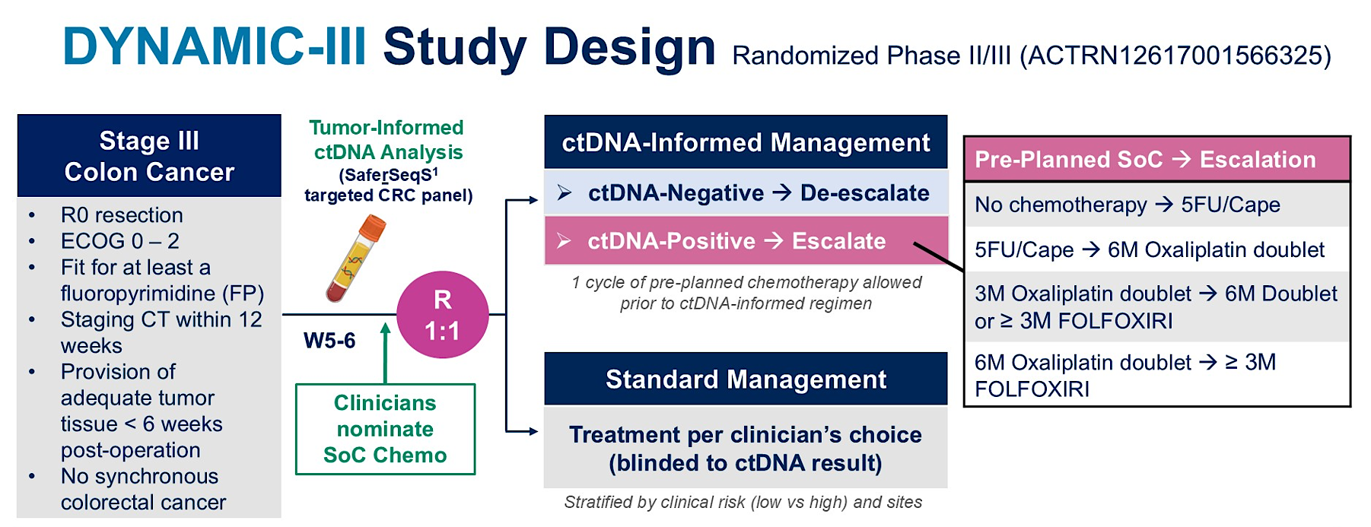
Jeanne Tie, MBChB FRACP MD

Slide 80
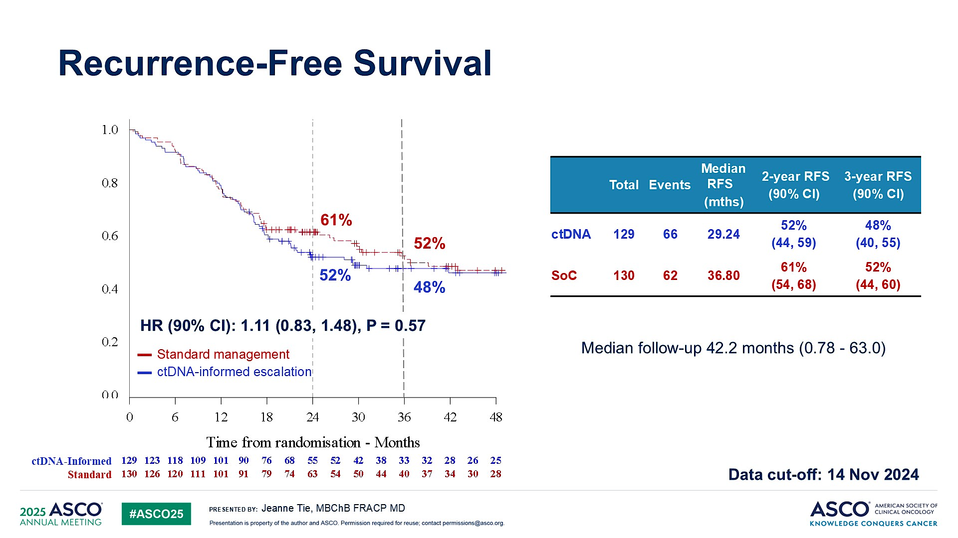
Tie J et al. Nat Med 2025

Slide 81

DYNAMIC-III Study Design Randomised Phase II/III (ACTRN12617001566325)
Stage III
Colon Cancer
Tumour-Informed
ctDNA Analysis
(SaferSeqS¹
targeted CRC panel)
ctDNA-Informed Management
Pre-Planned SoC → De-escalation
6M FP → No chemo or 3M FP
3M Oxaliplatin + FP → 3-6M FP
6M Oxaliplatin + FP → 3M Oxaliplatin + FP or 6M FP
ctDNA-Negative → De-escalate
ctDNA-Positive → Escalate
R0 resection
ECOG 0 – 2
Fit for at least a fluoropyrimidine (FP)
Staging CT within 12 weeks
Provision of adequate tumor tissue < 6 weeks post-operation
No synchronous colorectal cancer
R
1:1
1 cycle of pre-planned chemotherapy allowed prior to ctDNA-informed regimen
W5-6
FP = fluoropyrimidine
Standard Management
Clinicians nominate
SoC Chemo
Treatment per clinician’s choice
(blinded to ctDNA result)
Stratified by clinical risk (low vs high) and sites
Primary Analysis of ctDNA-Negative Cohort: Endpoints to be Presented Here
Primary: 3-year recurrence-free survival (RFS) | Secondary: treatment adherence, safety
Jeanne Tie
1. Cohen, J.D. et al. Nat Biotechnol 39, 1220–1227 (2021)

Slide 82
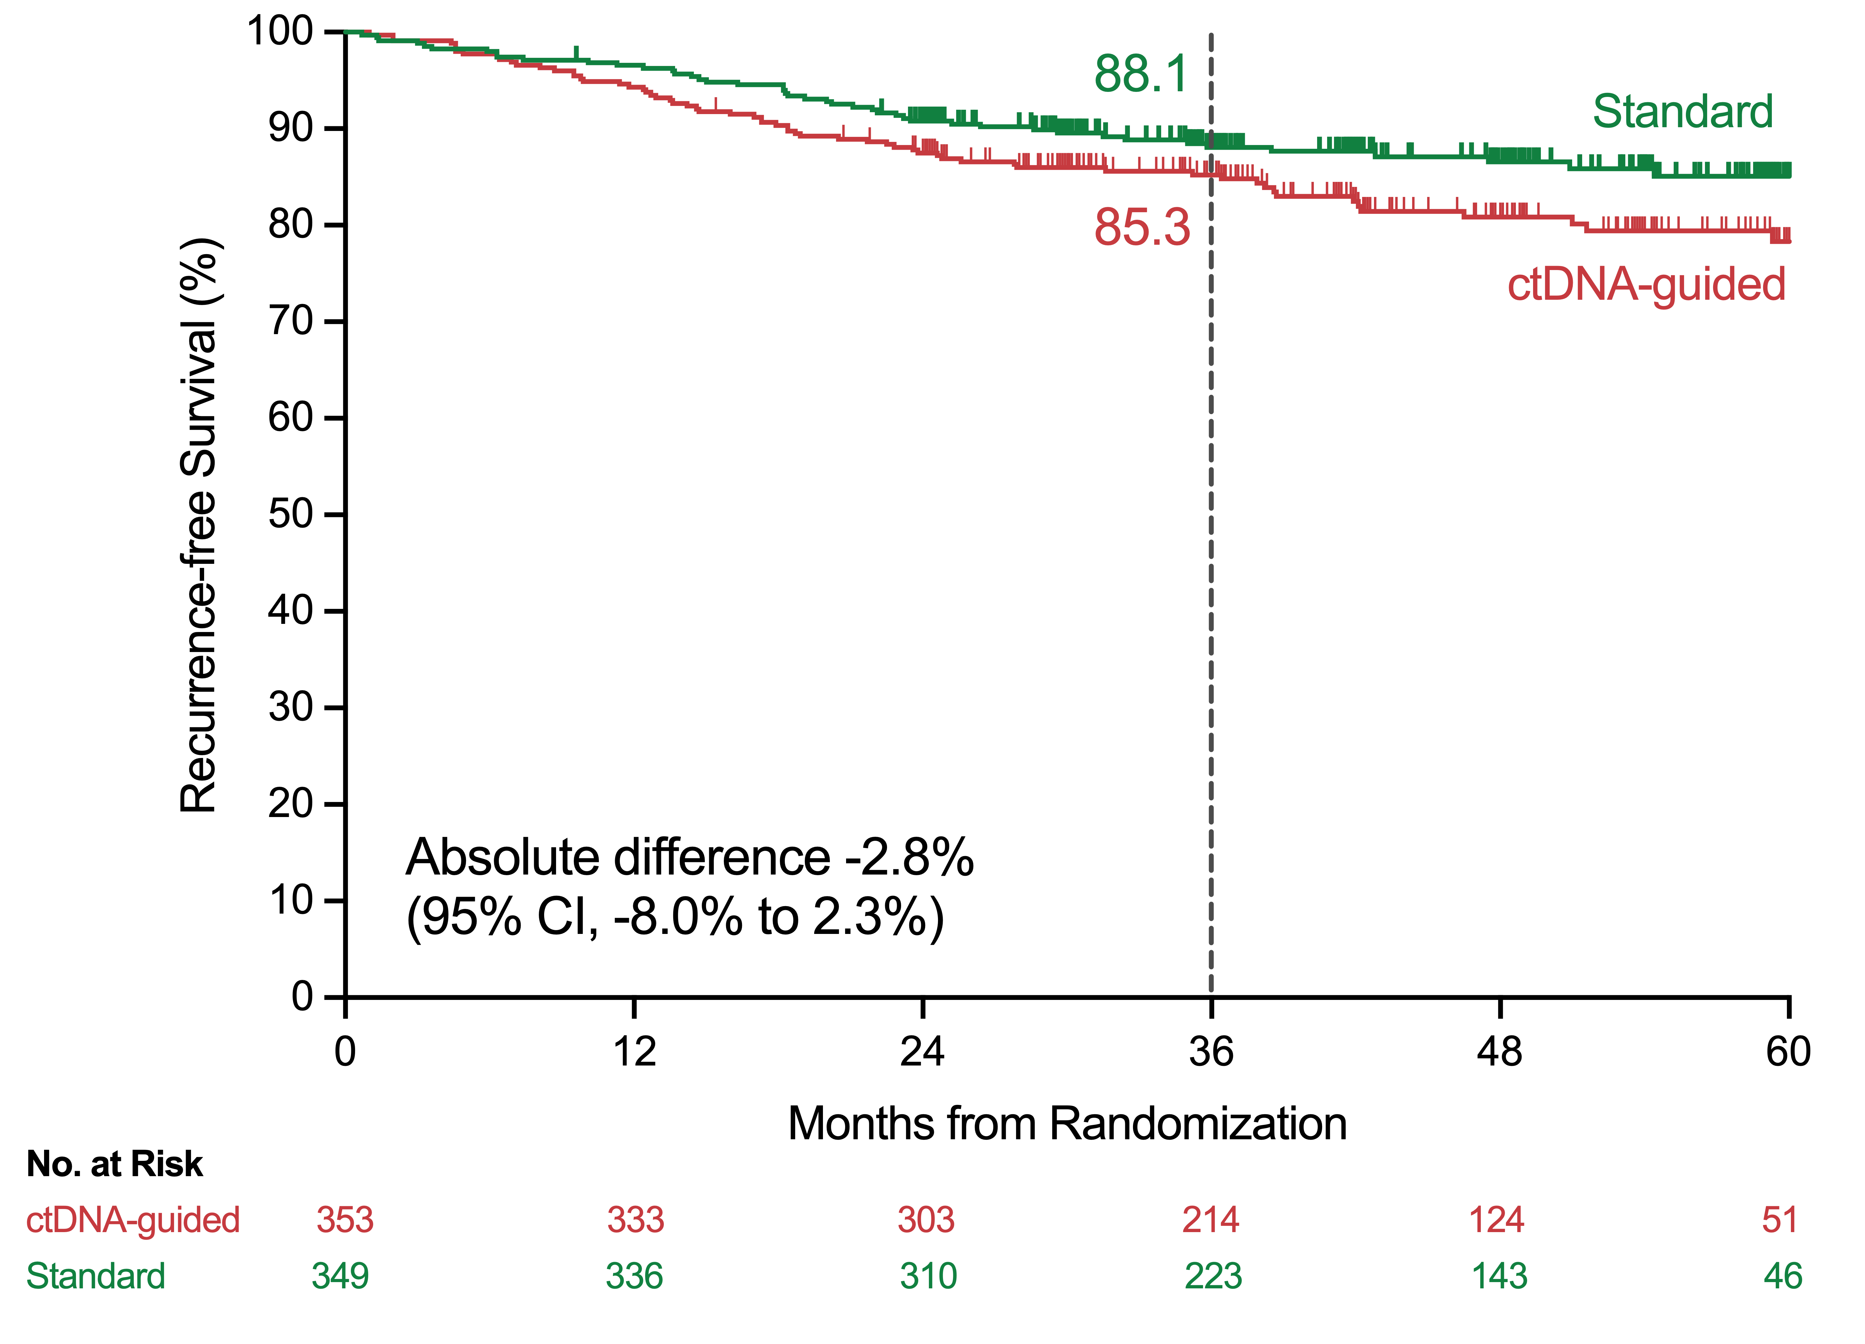
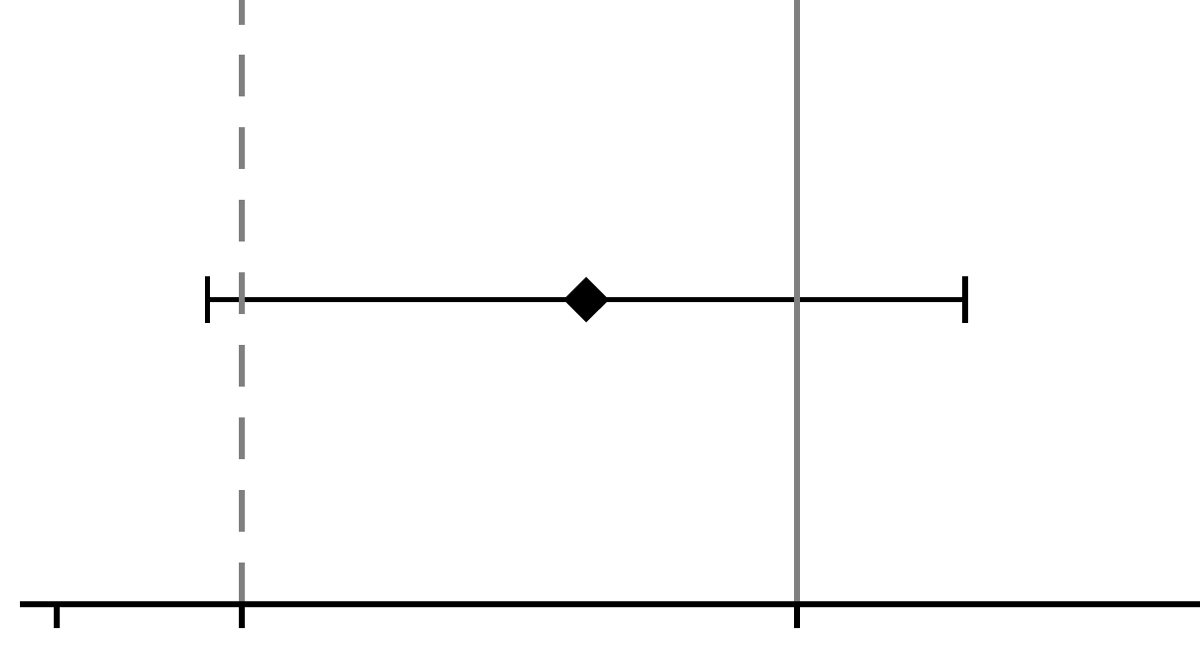
Recurrence-Free Survival
Median follow-up 47 months (0.68 - 67.0)
Arm | Total | Events | 3-year RFS (95% CI)
ctDNA | 353 | 63 | 85.3% (81, 89)
Standard | 349 | 45 | 88.1% (84, 91)
Absolute Difference in 3-year RFS (95% CI)
-8.0%
-10.0 -7.5 -5.0 -2.5 0 2.5
Standard better
ctDNA-guidance better
Jeanne Tie
Database lock July 29, 2025
Tie J et al. Nat Med 2025

Slide 83
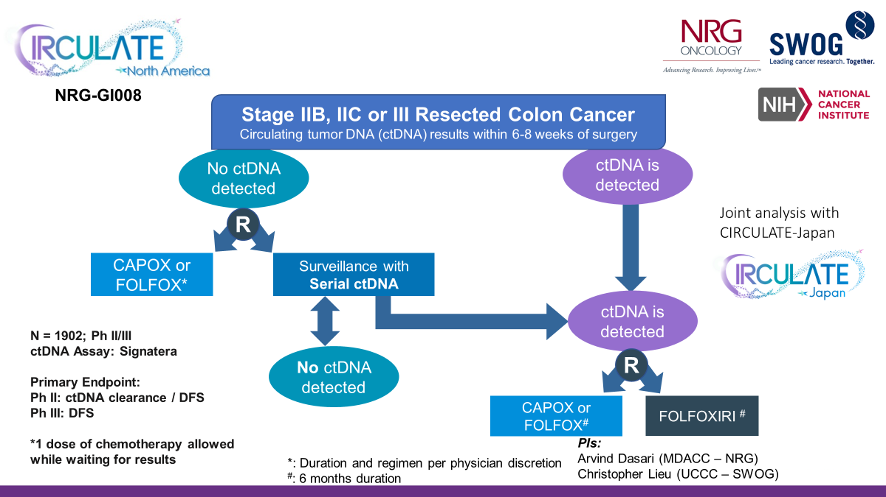
CIRCULATE – North America (NRG-GI008):
Case Study in Research to Practice
Since initiation, eligibility criteria expanded
Ongoing discussions to:
Link on & off study testing
NCT05174169
Arvind Dasari, MD, MS

Slide 84


Clinical Validity : Timepoints & Applications
Lead time prior to recurrence: 9 mos
Phan et al, Nat Rev Cancer. 2020 Jul;20(7):398-411
Reinert et al, JAMA Oncology. JAMA Oncol. 2019 Aug 1;5(8):1124-1131
Arvind Dasari, MD, MS

Slide 85

CALGB 80702 Trial: Effect of Celecoxib Added to Adjuvant Therapy : Initial Analysis (All Patients)
HR = 0.89 (95% CI, 0.76 – 1.03)
Meyerhardt et al, JAMA 2021

Slide 86

Slide 14
CALGB 80702 Study Re-Analysis According to ctDNA Status
Zhang GQ et al. JAMA Oncol. 2025

Slide 87


Slide 88

ALTAIR Study Results
Bando et al GI ASCO 2025

Slide 89

Ongoing ctDNA Trials
Phase 3 STELLAR-316 Pivotal Trial Planned for Patients with Colorectal Cancer
Press Release: May 19, 2026
Zanzalintinib with and without pembrolizumab sc in patients with resected stage II/IIICRC who, following definitive therapy, have tested positive for molecular residual disease (MRD+). The primary endpoint of the trial will be disease-free survival, with key secondary endpoints including circulating tumor DNA clearance.
A phase 2 randomized study comparing telisotuzumab adizutecan monotherapy with standard of care in patients with post-adjuvant circulating tumor DNA-positive colorectal cancer (NCT07023289)
Raghav et al, GI ASCO 2026; Exelixis Press Release, 5/19/26

Slide 90
Benefit of Adjuvant Chemotherapy in Resected Stage I-IV CRC Patients Based on ctDNA Dynamics Across Two Timepoints: Results from GALAXY Study
Yokota M et al.
ASCO 2026; Abstract 102.
ctDNA in Clinical Practice: From Early Detection to Clinical Decision-Making
Clinical Science Symposium
SATURDAY, MAY 30, 2026
8:00 – 9:30 AM CDT

Slide 91
Disease-Free Survival (DFS) and Time to Recurrence (TTR) with Circulating Tumor (ct) DNA–Based Decision for Adjuvant Treatment in Colon Cancer Stage II (CIRCULATE): An AIO
(KRK-0217)/ABCSG Trial
Folprecht G et al.
ASCO 2026; Abstract LBA3500.
Gastrointestinal Cancer—Colorectal and Anal
SUNDAY, MAY 31, 2026
8:00 – 8:12 AM CDT

Slide 92
Key Takeaway Points
MRD assays available for clinical use in the United States and approved by CMS
Clinical validity established by observational studies; prospective clinical utility studies are ongoing
Unique opportunity to integrate research & clinical practice for efficient and rapid generation of missing data

Slide 93
Outside of a clinical trial setting, to what extent do you use ctDNA-based MRD testing in the following scenarios?
Resected Stage II colon cancer
with no high-risk features
Resected Stage II colon cancer
with high-risk features
Occasionally
Commonly
Usually or always
Usually or always
Usually or always
Usually or always
Usually or always
Usually or always
Commonly
Commonly
Occasionally
Commonly

Slide 94
Outside of a clinical trial setting, to what extent do you use ctDNA-based MRD testing in the following scenarios?
Resected Stage III colon cancer with low-risk features
Resected Stage III colon cancer with high-risk features
Commonly
Commonly
Usually or always
Usually or always
Usually or always
Usually or always
Usually or always
Usually or always
Commonly
Commonly
Commonly
Commonly

Slide 95
Outside of a clinical trial setting, to what extent do you use ctDNA-based MRD testing in the following scenarios?
Resected oligometastatic disease
Localized rectal cancer
Usually or always
Commonly
Usually or always
Commonly
Usually or always
Usually or always
Usually or always
Usually or always
Usually or always
Occasionally
Commonly
Commonly

Slide 96
Outside of a clinical trial, would you be comfortable omitting or de-escalating adjuvant systemic therapy on the basis of negative ctDNA results alone for a _____________ with Stage II CRC and high-risk features?
Younger patient (eg, 65 years old)
Older patient (eg, 85 years old
and somewhat frail)
No
Yes
No
Yes
No
Yes
Yes
Yes
No
Yes
No
Yes

Slide 97
Faculty Discussion
Outside of a clinical trial setting, to what extent do you use ctDNA-based MRD testing in the following scenarios?
  Stage II colon cancer with no high-risk features
  Stage II colon cancer with high-risk features
  Stage III colon cancer with low-risk features
  Stage III colon cancer with high-risk features
  Colorectal cancer and fully resected oligometastatic disease
  Localized rectal cancer
Outside of a clinical trial, would you be comfortable omitting or de-escalating adjuvant systemic therapy on the basis of negative ctDNA results alone for a younger patient (eg, age 65) with Stage II CRC and high-risk features? Older patient (eg, 85 years old and somewhat frail)?

Slide 98
If you were to use serial ctDNA testing for a patient with localized CRC who had undergone surgical resection with or without adjuvant systemic therapy, at what intervals would you do so?
Every 3 months for 2-3 years
Post-surgery/pre-chemo, after 3 months of chemo,
q3m x 2 years total
Every 3-6 months along with CEA
Every 3 months for 2 years, then every 6 months for 3 years
Every 3 months for 2 years
Every 3 months
CEA = carcinoembryonic antigen

Slide 99
Have you employed or would you employ ctDNA testing to monitor for response to adjuvant therapy in patients with localized CRC?
I have not and would not
I have
I have
I have not but would for the right patient
I have
I have

Slide 100
A 65-year-old patient presents with microsatellite-stable (MSS) Stage II CRC with no high-risk features and undergoes R0 resection. What would be your approach to adjuvant therapy?
Observation
Observation
Check MRD and offer FOLFOX/CAPOX if positive. Offer 3 mo of capecitabine or 5-FU if the patient wants to do adjuvant tx
Observation
Observation
Observation

Slide 101
A 65-year-old patient presents with MSS Stage II CRC with no high-risk features and undergoes R0 resection. If a ctDNA assay were ordered, what would be your approach to treatment if the results were positive?
Close observation (shortened intervals)
Observation
FOLFOX/CAPOX
FOLFOX/CAPOX
FOLFOX/CAPOX
FOLFOX/CAPOX

Slide 102
Faculty Discussion
If you were to use serial ctDNA testing for a patient with localized CRC who had undergone surgical resection with or without adjuvant systemic therapy, at what intervals would you do so?
Have you employed or would you employ ctDNA testing to monitor for response to adjuvant therapy in patients with localized CRC?
A 65-year-old patient presents with MSS Stage II CRC with no high-risk features and undergoes R0 resection. What would be your approach to adjuvant therapy?
A 65-year-old patient presents with MSS Stage II CRC with no high-risk features and undergoes R0 resection. If a ctDNA assay were ordered, what would be your approach to treatment if the results were positive?

Slide 103
Agenda
Module 1: Current and Future Role of Immune Checkpoint Inhibition in the Management of Microsatellite Instability-High (MSI-H)/Mismatch Repair Deficient (dMMR) Localized and Locally Advanced Colorectal Cancer (CRC) — Dr Cohen
Module 2: Clinical Relevance and Practical Utilization of Molecular Residual Disease (MRD) Analysis in CRC — Dr Dasari
Module 3: Recent Advances in Metastatic CRC (mCRC): Optimizing Immunotherapy and Other Approaches — Dr Bekaii-Saab

Slide 104
Recent Advances in Metastatic CRC (mCRC): Optimizing Immunotherapy and Other Approaches
Tanios Bekaii-Saab, MD , FACP, FASCO
David F. and Margaret T. Grohne Professor of Novel Therapeutics for Cancer Research I
Chair and Consultant, Division of Hematology and Medical Oncology
Professor, Mayo Clinic College of Medicine and Science
Mayo Clinic in Arizona

Slide 105
Actionable colorectal cancer targets in 2026
Tanios Bekaii-Saab, MD

Slide 106


KEYNOTE-177: 1L Pembrolizumab vs. Chemo in MSI-H mCRC
Presented by KK Shiu, ASCO GI 2021

Slide 107

CheckMate 8HW study design
85%
Content of this presentation is the property of the author, licensed by ASCO. Permission required for reuse.
Lenz H et al. ASCO 2025; Andre T et al. ASCO GI 2025; Lonardi S et al. ESMO 2025

Slide 108


mPFS: Nivo + Ipi vs. Chemo all Lines
mPFS: Nivo + Ipi vs. Nivo all Lines
Lenz H et al. ASCO 2025; Andre T et al. ASCO GI 2025

Slide 109


mPFS: Nivo + Ipi vs. Nivo 1L MSI-H mCRC
Lonardi S et al ESMO 2025

Slide 110

Content of this presentation is the property of the author, licensed by ASCO. Permission required for reuse.
Lenz H et al. ASCO 2025

Slide 111

SEAMARK Phase 2 Study: Immunotherapy +/-
Encorafenib/Cetuximab in BRAF^{V600E}, MSI-H
Elez, E., Kopetz, S., Tabernero, J., Bekaii-Saab, T., Taieb, J., Yoshino, T., … Morris, V. K. Future Oncology (2024).

Slide 112
Conclusions
Test for mismatch repair deficiency/microsatellite instability at diagnosis for every stage of CRC
Ensure adequate diagnostic testing methods
ICIs are a very helpful therapeutic strategy in most MSI-H/dMMR CRC
Toxicity profile relatively favorable for majority of patients on single agent PD1i ( > with + CTLA4i)
Need biomarkers to help predict response, non-response to ICIs
Molecular markers, Lynch vs. non-Lynch, tumor microenvironment, others
Optimal duration of therapy and role of singlet vs. doublet ICIs remains relatively unclear
Single agent ICI for Lynch patients and doublet for select in need of Response (especially + BRAF V600E MT) …
Cross over from singlet to doublet ?
Circulating tumor DNA may be helpful for assessing/quantifying response

Slide 113

The Path Forward For pMMR (MSS) mCRC
Cancer-immunity Cycle:
Fc-engineered CTLA-4
Are there subsets with immune responsiveness?
dMMR
Non-liver metastases
Primary
CMS1+ CMS3 pMMR
POLE
TMB high
ctDNA
Anti-VEGF
Ni JJ et al. Acta Pharmacol Sin. 2023;44(2):288-307.
Mellman I et al. Immunity. 2023;56(10):2188-2205.
Chen DS et al. Immunity. 2013;39(1):1-10.

Slide 114







Randomized PII/III studies with IO+ for MSS mCRC: From Negative to Borderline Positive
Imblaze 370 : Ref L Atezo +/- cobi vs. Rego
BACCI : Ref L Cape/Bev +/- Atezo/PBO
MODUL : Maint FP/Bev +/- Atezo
CO.26 : Ref L Tremi/Durva vs. BSC
CM 9X8: 1L mFOLFOX6 + Bev +/- Nivo
AtezoTRIBE: 1L FOLFOXIRI/Bev +/- Atezo
LEAP 017: Lenva + Pembro vs. SOC

Slide 115


S2107 Study Schema: Encorafenib/Cetuximab +/- Nivolumab
pMMR / MSS, BRAF^{V600E} metastatic and/or unresectable
colorectal patients with ≥1 prior line of systemic therapy
R
R
Arm 1
NEGATIVE
Arm 2
Encorafenib +
cetuximab +
nivolumab
N= 75 participants
2:1 randomization (Arm 1: Arm 2)
Encorafenib +
cetuximab
Primary endpoint: PFS
PI: Van Morris

Slide 116

Zanzalintinib + atezolizumab: MOA
Saeed A, et al. Future Oncol. 2024;20:1733-1743.

Slide 117
STELLAR-303 (NCT05425940) Study Design
Patient Population
Zanzalintinib 100 mg PO QD + Atezolizumab 1200 mg IV Q3W
(n=451)*
Aged ≥18 years
Documented to not have MSI-H or dMMR status
mCRC that radiographically progressed on or was refractory or intolerant to prior standard-of-care therapy, which had to include all the following (if approved and available in the country where the patient is randomized):
Fluoropyrimidine, irinotecan and oxaliplatin ± anti-VEGF antibody
Anti-EGFR antibody (if RAS wild type)
BRAF inhibitor (if known BRAF V600E mutation)
R 1:1
N=901
Regorafenib 160 mg PO QD
(days 1-21 of each 28-day cycle)
(n=450)*
Stratification Factors
Endpoints | Durvalumab + GemCis (n = 341)
Dual primary | OS in the ITT population OS in patients without liver metastases (nlmlTT)
Key secondary | PFS,† ORR,† Safety‡
Geographic region (Asia/rest of the world)
RAS status (wild type/mutant)
Presence of liver metastases (yes/no)
Saeed, A et al. ESMO 2025

Slide 118
STELLAR-303: Efficacy
OS Analysis (ITT Population)
PFS (ITT Population)
Outcome | Zanzalintinib + Atezolizumab (n=451) | Regorafenib (n=450)
Median OS, months | 10.9 | 9.4
HR, 0.80 (95% CI, 0.69-0.93); P=0.0045*
Outcome | Zanzalintinib + Atezolizumab (n=451) | Regorafenib (n=450)
Median PFS, months | 3.7 | 2.0
HR, 0.68 (95% CI, 0.59-0.79)*
46%
38%
20%
10%
The interim analysis in the nlmITT population (dual primary endpoint) showed a trend in OS favoring the combination (stratified HR, 0.79
[95% CI, 0.61-1.03; P=0.087]; median, 15.9 versus 12.7 months with regorafenib)
PFS for zanzalintinib + atezolizumab versus regorafenib was generally consistent across subgroups
*Statistical significance for PFS cannot be claimed at this analysis per the prespecified hierarchical testing strategy. ITT, intention to treat; PFS, progression-free survival.
Hecht, R et al. Lancet Nov. 2025

Slide 119
STELLAR-303: Efficacy
OS Subgroup Analyses (ITT Population)-Key Subgroups
Best Overall Response (ITT Population)
An OS benefit with zanzalintinib + atezolizumab vs regorafenib was consistently observed across key subgroups
Subgroup | HR (95% CI) | Zanzalintinib + Atezolizumab median OS, months | Regorafenib median OS, months
Geographic region
Asia | 0.77 (0.59-1.00) | 11.5 | 8.8
Rest of the world | 0.82 (0.68-0.99) | 10.9 | 9.8
RAS status
Wild type | 0.79 (0.61-1.01) | 12.0 | 10.4
Mutant | 0.80 (0.66-0.98) | 10.3 | 8.7
Liver metastases
Yes | 0.78 (0.65-0.94) | 8.9 | 7.7
No | 0.77 (0.59-1.01) | 15.9 | 12.7
Prior anti-VEGF antibody treatment
Yes | 0.80 (0.68-0.95) | 10.5 | 8.8
No | 0.80 (0.56-1.15) | 11.5 | 11.1
Response Outcome | Zanzalintinib + Atezolizumab (n=451) | Regorafenib (n=450)
Best overall response, n (%)*
Complete response | 0 | 0
Partial response | 16 (4) | 5 (1)
Stable disease | 226 (50) | 178 (40)
Progressive disease | 156 (35) | 216 (48)
Not evaluable | 53 (12) | 51 (11)
Objective response rate, n (%) | 16 (4) | 5 (1)
95% CI | (2-6) | (0-3)
Disease control rate, n (%) | 242 (54) | 183 (41)
95% CI | (49-58) | (36-45)
Hecht, R et al. Lancet Nov. 2025

Slide 120
STELLAR-303: Safety
Event, n (%) | Zanzalintinib + Atezolizumab (n=446) | Regorafenib (n=434)
Treatment-related adverse events
Any-grade | 423 (95) | 399 (92)
Grade 3 | 248 (56) | 143 (33)
Grade 4 | 15 (3) | 17 (4)
Serious adverse events | 255 (57) | 184 (42)
Serious treatment-related adverse events | 118 (26) | 45 (10)
Adverse events leading to discontinuation of all treatment | 82 (18) | 64 (15)
Dose modification due to an adverse event*
Dose reduction of zanzalintinib/regorafenib | 270 (61) | 174 (40)
Dose delay of atezolizumab | 193 (43) | NA
Summary of TRAEs* (Safety Population)
Zanzalintinib + Atezolizumab (n=446)
Regorafenib (n=434)
Any Grade
Grade ≥3
Any Grade
Grade ≥3
Most frequent AEs leading to discontinuation of zanzalintinib + atezolizumab: abdominal pain, asthenia, and general physical health deterioration (4 [1%] patients each)
Deaths considered related to treatment by investigators: intestinal perforation (n=2) for zanzalintinib, pneumonitis and renal failure (n=1 each) for atezolizumab, altered state of consciousness (n=1) for zanzalintinib + atezolizumab, and jejunal perforation (n=1) for regorafenib
Hecht, R et al. Lancet Nov. 2025

Slide 121
FDA Accepts the New Drug Application for Zanzalintinib in Combination with Atezolizumab for mCRC
The manufacturer announced that a New Drug Application (NDA) for zanzalintinib, in combination with atezolizumab, has been accepted for review in the U.S. for the treatment of adult patients with metastatic colorectal cancer (mCRC) who have been previously treated with fluoropyrimidine-, oxaliplatin- and irinotecan-based chemotherapy, and, if RAS wild-type, an anti-epidermal growth factor receptor (EGFR) therapy.
The Food and Drug Administration (FDA) assigned a standard review with a Prescription Drug User Fee Act target action date of December 3, 2026.
The NDA is based on the results of the phase 3 STELLAR-303 pivotal trial, in which zanzalintinib in combination with atezolizumab demonstrated a statistically significant improvement in overall survival (OS) versus regorafenib in the intention-to-treat (ITT) population of patients with previously treated CRC.
https://ir.exelixis.com/news-releases/news-release-details/exelixis-announces-us-fda-accepted-new-drug-application

Slide 122







Target : EGFR/MET ( Bispecific)
OrigAMI-1
(Doublet chemo + amivantamab in RAS/BRAF WT mCRC
OrigAMI-2
(Doublet chemo + amivantamab vs cetuximab in 1L, left-sided mCRC)
OrigAMI-3
(FOLFIRI + amivantamab vs bev/cetux in 2L mCRC)
Arnold D et al. ASCO 2025. Abstract TPS3636; Chen EX et al. ASCO GI 2026; Harrington KJ et al. ESMO 2025; Hecht JR et al. ASCO 2025. Abstract TPS3638

Slide 123


Progression Free Survival
BREAKWATER: First-line Encorafenib + Cetuximab ± Chemotherapy Versus SOC in Patients With BRAF V600E–Mutant mCRC
Overall Survival
Elez E et al. ASCO 2025. Abstract LBA3500.
Elez E et al. NEJM. 2025

Slide 124
Overview of Response by BICR
EC + FOLFIRI demonstrated statistically significant and clinically meaningful benefit in ORR by BICR, meeting the primary endpoint
Confirmed ORR by BICR
Confirmed Best Overall Response, TTR, and DOR by BICR
Odds ratio (95% CI): 2.756 (1.420-5.348)
One-sided P-value=0.0011
 | EC + FOLFIRI n=73 | Controlª n=74
Confirmed best overall response, n (%)
CR | 3 (4.1) | 1 (1.4)
PR | 44 (60.3) | 28 (37.8)
SD | 15 (20.5) | 25 (33.8)
Non-CR/non-PD^{b} | 1 (1.4) | 0
PD | 1 (1.4) | 8 (10.8)
Not evaluable | 9 (12.3) | 12 (16.2)
TTR, median (range), weeks | 6.9 (5.4-36.1) | 7.1 (5.9-25.3)
Estimated DOR, median (range), months | NE (NE-NE) | NE (7.0-NE)
Patients with a DOR of ≥6 months, n (%) | 27 (57.4) | 10 (34.5)
Patients with a DOR of ≥12 months, n (%) | 2 (4.3) | 0
64.4%
(52.9%-74.4%)
CR
PR
39.2%
(28.9%-50.6%)
Percentage of patients
n=73
n=74
ªFOLFIRI ± bevacizumab. ^{b}Patients with only non-target lesions at baseline by BICR.
BICR, blinded independent central review; CR, complete response; DOR, duration of response; EC, encorafenib plus cetuximab; FOLFIRI, fluorouracil/leucovorin/irinotecan; NE, not estimable; PD, progressive disease; PR, partial response; SD, stable disease; TTR, time to response.
Kopetz S et al. ASCO GI 2026

Slide 125
Data of HER2-targeted therapies in patients with mCRC
Regimen | Trial (n) – year | ORR | DOR | PFS | OS | Most common Grade 3+ AEs
Trastuzumab + lapatinib | HERACLES-A (n=32) – 2016 | 28% | NR | 4.7m | 10m | Fatigue 16% Decreased LVEF 6%
Trastuzumab + pertuzumab | MyPathway (n=57) – 2019 | 32% | 5.9m | 2.9m | 11.5m | Hypokalemia 5% Abdominal pain 5%
Pertuzumab and T-DM1 | HERACLES-B (n=31) – 2020 | 9.7% | NR | 4.1m | Not reported | Thrombocytopenia 7%
Trastuzumab deruxtecan (6.4 mg/Kg) | DESTINY-CRC01 (N=78; 53 HER2+) – 2021 | 45.3% | 7m | 6.9m | 15.5m | Neutropenia 15% Anemia 13%
Trastuzumab deruxtecan ( 5.4 mg/Kg) | DESTINY-CRC02 (N=82) – 2023 | 37.8% | 5.5m | 5.8m | 13.4m | Neutropenia 17% Fatigue 10% Nausea 8%
Tucatinib + trastuzumab | MOUNTAINEER (n=117) - 2023 | 38.1% | 12.4m | 8.2m | 24.1m | Hypertension 7% Diarrhea 3.5%
Tosi F, Sartore-Bianchi A, et al. Clin Colorectal Cancer. 2020 Dec;19(4):256-262.e2. doi: 10.1016/j.clcc.2020.06.009. Epub 2020 Jun 27.
Meric-Bernstam F, et al. Lancet Oncol. 2019 Apr;20(4):518-530. doi: 10.1016/S1470-2045(18)30904-5. Epub 2019 Mar 8.
Raghav KPS, et al. ASCO 2023.
Sartore-Bianchi A, et al. ESMO Open. 2020 Sep;5(5):e000911.
Siena S, et al; Lancet Oncol. 2021 Jun;22(6):779-789. doi: 10.1016/S1470-2045(21)00086-3. Epub 2021 May 4.
Strickler J et al; Lancet Oncology , 2023.

Slide 126

Target : HER2+ in mCRC
Bekaii_Saab T et al . ASCO 2023

Slide 127



KRAS G12C MT and mCRC
Yaeger R et al. Cancer Discov 2024
Sacher AG et al. ASCO 2025

Slide 128


Kawazoe A, et al. ASCO GI 2026
Kim TW, et al. ASCO GI 2025

Slide 129
Metastatic CRC with Unresectable Metastases
MSI-H
BRAF V600E MT
Ras MT
RAS/BRAF WT
Pembrolizumab or Nivolumab/Ipilimumab
Encorafenib/Cetuximab + CT D
Bevacizumab + CT D/T
Left Sided
Right Sided
Her-2 Amplified
Bevacizumab + CT D/T
Follow algorithm
Bevacizumab + CT D
Bevacizumab + CT D
Bevacizumab + CT D
EGFRi + CT D
Bevacizumab + CT D
Bevacizumab + CT D
Kras G12C MT
Her-2 Amplified
EGFRi + Irinotecan
Adagrasib/Cetuximab
Sotorasib/Panitumumab
Dual anti-HER-2 Agents
Bevacizumab + CT D
Trastuzumab Deruxtecan
CT= Chemotherapy
D= Doublet
T= Triplet
NTRK / RET fusions
TMB > 10
Regorafenib
Fruquintinib
TAS-102 +/- Bevacizumab
Zanzalintinib + Atezolizumab ?
BSC
Tanios Bekaii-Saab, MD

Slide 130
What first-line treatment would you most likely recommend for a 60-year-old patient who presents with left-sided, pan-RAS wild-type, BRAF wild-type, HER2-negative, MSI-H mCRC?
Clinically stable
Highly symptomatic
Nivolumab/ipilimumab
Nivolumab/ipilimumab
Nivolumab/ipilimumab
Nivolumab/ipilimumab
Nivolumab/ipilimumab
Nivolumab/ipilimumab
Nivolumab/ipilimumab
Nivolumab/ipilimumab
Nivolumab/ipilimumab
Nivolumab/ipilimumab
Nivolumab/ipilimumab
Nivolumab/ipilimumab

Slide 131
What first-line treatment would you most likely recommend for a clinically stable 60-year-old patient who presents with left-sided, pan-RAS wild-type, BRAF-mutant, HER2-negative, MSI-H mCRC?
Nivolumab/ipilimumab
Nivolumab/ipilimumab
Nivolumab/ipilimumab
Nivolumab/ipilimumab
Nivolumab/ipilimumab
Nivolumab/ipilimumab

Slide 132
Have you used or would you use a ctDNA assay to determine whether to discontinue immunotherapy for a patient with mCRC who is faring well?
I have not but would for the right patient
I have
I have
I have
I have not but would for the right patient
I have

Slide 133
Faculty Discussion
What first-line treatment would you most likely recommend for a 60-year-old patient who presents with left-sided, pan-RAS wild-type, BRAF wild-type, HER2-negative, clinically stable MSI-H mCRC? What if the patient were highly symptomatic?
What first-line treatment would you most likely recommend for a clinically stable
60-year-old patient who presents with left-sided, pan-RAS wild-type, BRAF-mutant, HER2-negative, MSI-H mCRC?
Have you used or would you use a ctDNA assay to determine whether to discontinue immunotherapy for a patient with mCRC who is faring well?

Slide 134
Do you believe there is therapeutic synergy between immune checkpoint inhibitors and multikinase inhibitors?
There are not enough available data at this time
Yes
Yes
Yes
There are not enough available data at this time
Yes

Slide 135
Do you believe that zanzalintinib/atezolizumab will be endorsed by the FDA for previously treated mCRC?
Yes
Yes
Yes
No
Yes
Yes

Slide 136
Would you like to be able to access zanzalintinib/atezolizumab today for your patients with previously treated mCRC?
Yes
No
Yes
No
Yes
Yes

Slide 137
In what line of therapy do you envision zanzalintinib/atezolizumab will be employed for patients with mCRC?
Third line or fourth line
Third or fourth line and later
Fourth line
Fourth line
Third line or fourth line
Third-line setting

Slide 138
Faculty Discussion
Do you believe there is therapeutic synergy between immune checkpoint inhibitors and multikinase inhibitors?
Do you believe that zanzalintinib/atezolizumab will be endorsed by the FDA for previously treated mCRC?
Would you like to be able to access zanzalintinib/atezolizumab today for your patients with previously treated mCRC?
In what line of therapy do you envision zanzalintinib/atezolizumab will be employed for patients with mCRC?

Slide 139
Consensus or Controversy? Documenting and Discussing Investigators’ Approaches to the Management of Ovarian Cancer
Saturday, May 30, 2026
7:00 PM – 9:00 PM CT (8:00 PM – 10:00 PM ET)
Faculty
Ramez N Eskander, MD
Ursula Matulonis, MD
Alexander B Olawaiye, MD
David M O’Malley, MD
Moderator
Kathleen N Moore, MD, MS

Slide 140
What Clinicians Want to Know:
Addressing Community Oncologists’ Questions
About the Care of Patients with Prostate Cancer
Saturday, May 30, 2026
7:00 PM – 9:00 PM CT (8:00 PM – 10:00 PM ET)
Faculty
Wassim Abida, MD, PhD
Rahul Aggarwal, MD
Emmanuel S Antonarakis, MD
Karim Fizazi, MD, PhD
Moderator
Rana R McKay, MD, FASCO

Slide 141
Second Opinion: Investigators Provide
Perspectives on the Current and Future
Management of Small Cell Lung Cancer
Saturday, May 30, 2026
7:00 PM – 9:00 PM CT (8:00 PM – 10:00 PM ET)
Faculty
Anne Chiang, MD, PhD
Apar Kishor Ganti, MD, MS
Luis Paz-Ares, MD, PhD
Moderator
Misty Dawn Shields, MD, PhD

Slide 142
Thank you for joining us!
Your feedback is very important to us.
Please complete the survey currently up on the iPads for attendees in the room and on Zoom for those attending virtually. The survey will remain open up to 5 minutes after the meeting ends.
How to Obtain CME Credit
In-person attendees: Please refer to the program syllabus for the CME credit link or QR code. Online/Zoom attendees:
The CME credit link is posted in the chat room.

