Slide 1
Cases from the Community: Investigators Discuss the Optimal Management of Chronic Lymphocytic Leukemia
Friday, May 29, 2026 6:30 PM – 8:30 PM CT (7:30 PM – 9:30 PM ET)
Faculty
John N Allan, MD
Bita Fakhri, MD, MPH
Shuo Ma, MD, PhD
Mazyar Shadman, MD, MPH
Moderator
Jeremy S Abramson, MD, MMSc

Slide 2

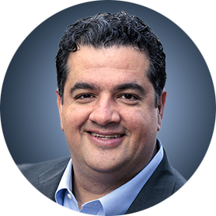
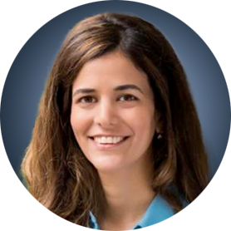


Faculty
John N Allan, MD
Associate Professor of Clinical Medicine
Weill Cornell Medicine
New York, New York
Mazyar Shadman, MD, MPH
Professor
Innovators Network Endowed Chair
Deputy Chief Medical Officer
Medical Director, Cellular Immunotherapy
Professor, Clinical Research Division
Fred Hutchinson Cancer Center and University of Washington
Seattle, Washington
Bita Fakhri, MD, MPH
Assistant Professor of Medicine (Hematology)
Stanford University School of Medicine
Stanford, California
Moderator Jeremy S Abramson, MD, MMSc
Director, Center for Lymphoma
Massachusetts General Hospital
Professor of Medicine
Harvard Medical School
Boston, Massachusetts
Shuo Ma, MD, PhD
Professor of Medicine
Division of Hematology-Oncology
Department of Medicine
Robert H Lurie Comprehensive Cancer Center
Northwestern University
Chicago, Illinois

Slide 3
Dr Allen — Disclosures Faculty
Advisory Committees | NeoGenomics
Consulting Agreements | AbbVie Inc, Adaptive Biotechnologies Corporation, ADC Therapeutics, AstraZeneca Pharmaceuticals LP, BeOne, Genentech, a member of the Roche Group, Janssen Biotech Inc, Lilly, Pharmacyclics LLC, an AbbVie Company
Contracted Research | Adaptive Biotechnologies Corporation, BeOne, Bristol Myers Squibb, Genentech, a member of the Roche Group
Data and Safety Monitoring Boards/Committees | Merck
Speakers Bureaus | AbbVie Inc, BeOne

Slide 4
Dr Fakhri — Disclosures Faculty
Advisory Committees | AbbVie Inc, AstraZeneca Pharmaceuticals LP, Genentech, a member of the Roche Group, Pharmacyclics LLC, an AbbVie Company
Contracted Research | AbbVie Inc, BeOne, Genmab US Inc, Loxo Oncology Inc, a wholly owned subsidiary of Eli Lilly & Company

Slide 5
Dr Ma — Disclosures Faculty
Advisory Committees | AbbVie Inc, AstraZeneca Pharmaceuticals LP, BeOne, Bristol Myers Squibb, Genentech, a member of the Roche Group, Lilly
Consulting Agreements | AbbVie Inc
Contracted Research | AbbVie Inc, AstraZeneca Pharmaceuticals LP, BeOne, Carna Biosciences, Juno Therapeutics, a Celgene Company, Loxo Oncology Inc, a wholly owned subsidiary of Eli Lilly & Company, Nurix Therapeutics Inc
Speakers Bureaus | AstraZeneca Pharmaceuticals LP, BeOne, Lilly

Slide 6
Dr Shadman — Disclosures Faculty
Advisory Committees and Consulting Agreements | AbbVie Inc, ADC Therapeutics, Ascentage Pharma, AstraZeneca Pharmaceuticals LP, BeOne, Bristol Myers Squibb, Fate Therapeutics, Genentech, a member of the Roche Group, Genmab US Inc, Incyte Corporation, Janssen Biotech Inc, Kite, A Gilead Company, Lilly, Merck, MorphoSys, Nurix Therapeutics Inc, Pfizer Inc, Pierre Fabre
Contracted Research | AstraZeneca Pharmaceuticals LP, BeOne, Genentech, a member of the Roche Group, Genmab US Inc, Incyte Corporation, Janssen Biotech Inc, Merck, MorphoSys, Nurix Therapeutics Inc, Sana Biotechnology
Stock Options — Private Companies | Koi Biotherapeutics Inc
Nonrelevant Financial Relationships | Bristol Myers Squibb (spouse employment)

Slide 7
Dr Abramson — Disclosures Moderator
Consulting Agreements | AbbVie Inc, ADC Therapeutics, AstraZeneca Pharmaceuticals LP, BeOne, Bristol Myers Squibb, Celgene Corporation, Foresight Diagnostics, a wholly-owned subsidiary of Natera Inc, Genentech, a member of the Roche Group, Gilead Sciences Inc, Interius BioTherapeutics, Miltenyi Biotec, Novartis, Roche Laboratories Inc, Seagen Inc
Contracted Research | Bristol Myers Squibb, Celgene Corporation, Cellectis, Genentech, a member of the Roche Group, Merck, Mustang Bio, Regeneron Pharmaceuticals Inc, Seagen Inc, Takeda Pharmaceuticals USA Inc

Slide 8
Research To Practice President Neil Love, MD —Disclosures
Dr Love is president and CEO of Research To Practice. Research To Practice receives funds in the form of educational grants to develop CME activities from the following companies: Aadi Bioscience, AbbVie Inc, ADC Therapeutics, Agendia Inc, Alexion Pharmaceuticals, Amgen Inc, Array BioPharma Inc, a subsidiary of Pfizer Inc, Arvinas, Astellas, AstraZeneca Pharmaceuticals LP, Aveo Pharmaceuticals, Bayer HealthCare Pharmaceuticals, BeOne, Biotheranostics Inc, A Hologic Company, Black Diamond Therapeutics Inc, Blueprint Medicines, Boehringer Ingelheim Pharmaceuticals Inc, Bristol Myers Squibb, Celcuity, Clovis Oncology, Coherus BioSciences, Corcept Therapeutics Inc, CTI BioPharma, a Sobi Company, Daiichi Sankyo Inc, Eisai Inc, Elevation Oncology Inc, Exact Sciences Corporation, Exelixis Inc, Genentech, a member of the Roche Group, Genmab US Inc, Geron Corporation, Gilead Sciences Inc, GSK, Helsinn Therapeutics (US) Inc, ImmunoGen Inc, Incyte Corporation, Ipsen Biopharmaceuticals Inc, Jazz Pharmaceuticals Inc, Johnson & Johnson, Karyopharm Therapeutics, Kite, A Gilead Company, Kura Oncology, Legend Biotech, Lilly, MEI Pharma Inc, Merck, Mersana Therapeutics Inc, Mirati Therapeutics Inc, Mural Oncology Inc, Natera Inc, Novartis, Novartis Pharmaceuticals Corporation on behalf of Advanced Accelerator Applications, Novocure Inc, Nuvalent, Nuvation Bio Inc, Pfizer Inc, Pharmacyclics LLC, an AbbVie Company, Puma Biotechnology Inc, Regeneron Pharmaceuticals Inc, Revolution Medicines Inc, Rigel Pharmaceuticals Inc, R-Pharm US, Sanofi, Seagen Inc, Servier Pharmaceuticals LLC, SpringWorks Therapeutics Inc, Stemline Therapeutics Inc, Sumitomo Pharma America, Summit Therapeutics, Syndax Pharmaceuticals, Taiho Oncology Inc, Takeda Pharmaceuticals USA Inc, TerSera Therapeutics LLC, and Tesaro, A GSK Company.

Slide 9
Commercial Support
This activity is supported by educational grants from AstraZeneca Pharmaceuticals LP and Lilly.
Research To Practice CME Planning Committee Members, Staff and Reviewers
Planners, scientific staff and independent reviewers for Research To Practice have no relevant financial relationships to disclose.

Slide 10
This educational activity contains discussion of non-FDA-approved uses of agents and regimens. Please refer to official prescribing information for each product for approved indications.

Slide 11



Clinicians in the Meeting Room
Networked iPads are available.
Review Program Slides: Tap the Program Slides button to review speaker presentations and other program content.
Answer Survey Questions: Complete the pre- and postmeeting surveys. Survey questions will be discussed throughout the meeting.
Ask a Question: Tap Ask a Question to submit a challenging case or question for discussion. We will aim to address as many questions as possible during the program.
For assistance, please raise your hand. Devices will be collected at the conclusion of the activity.
Notes:
11

Slide 12

Clinicians Attending via Zoom
Review Program Slides: A link to the program slides will be posted in the chat room at the start of the program.
Answer Survey Questions: Complete the pre- and postmeeting surveys.
Ask a Question: Submit a challenging case or question for discussion using the Zoom chat room.
Get CME Credit: A credit link will be provided in the chat room at the conclusion of the program.
Notes:
12

Slide 13
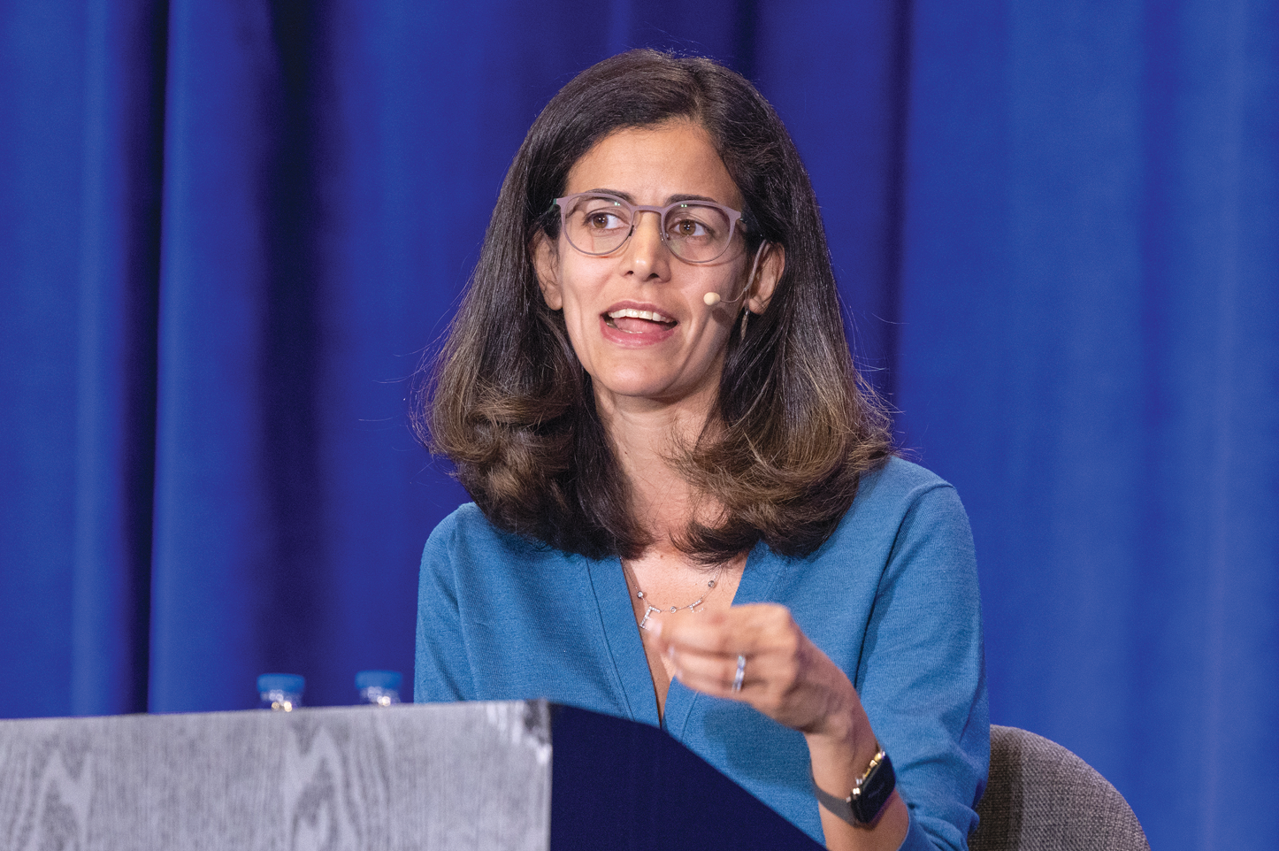
About the Enduring Program
The live meeting is being video and audio recorded.
The proceedings from today will be edited and developed into an enduring web-based program. An email will be sent to all attendees when the activity is available.
To learn more about our education programs, visit our website, www.ResearchToPractice.com
Notes:
13
13

Slide 14
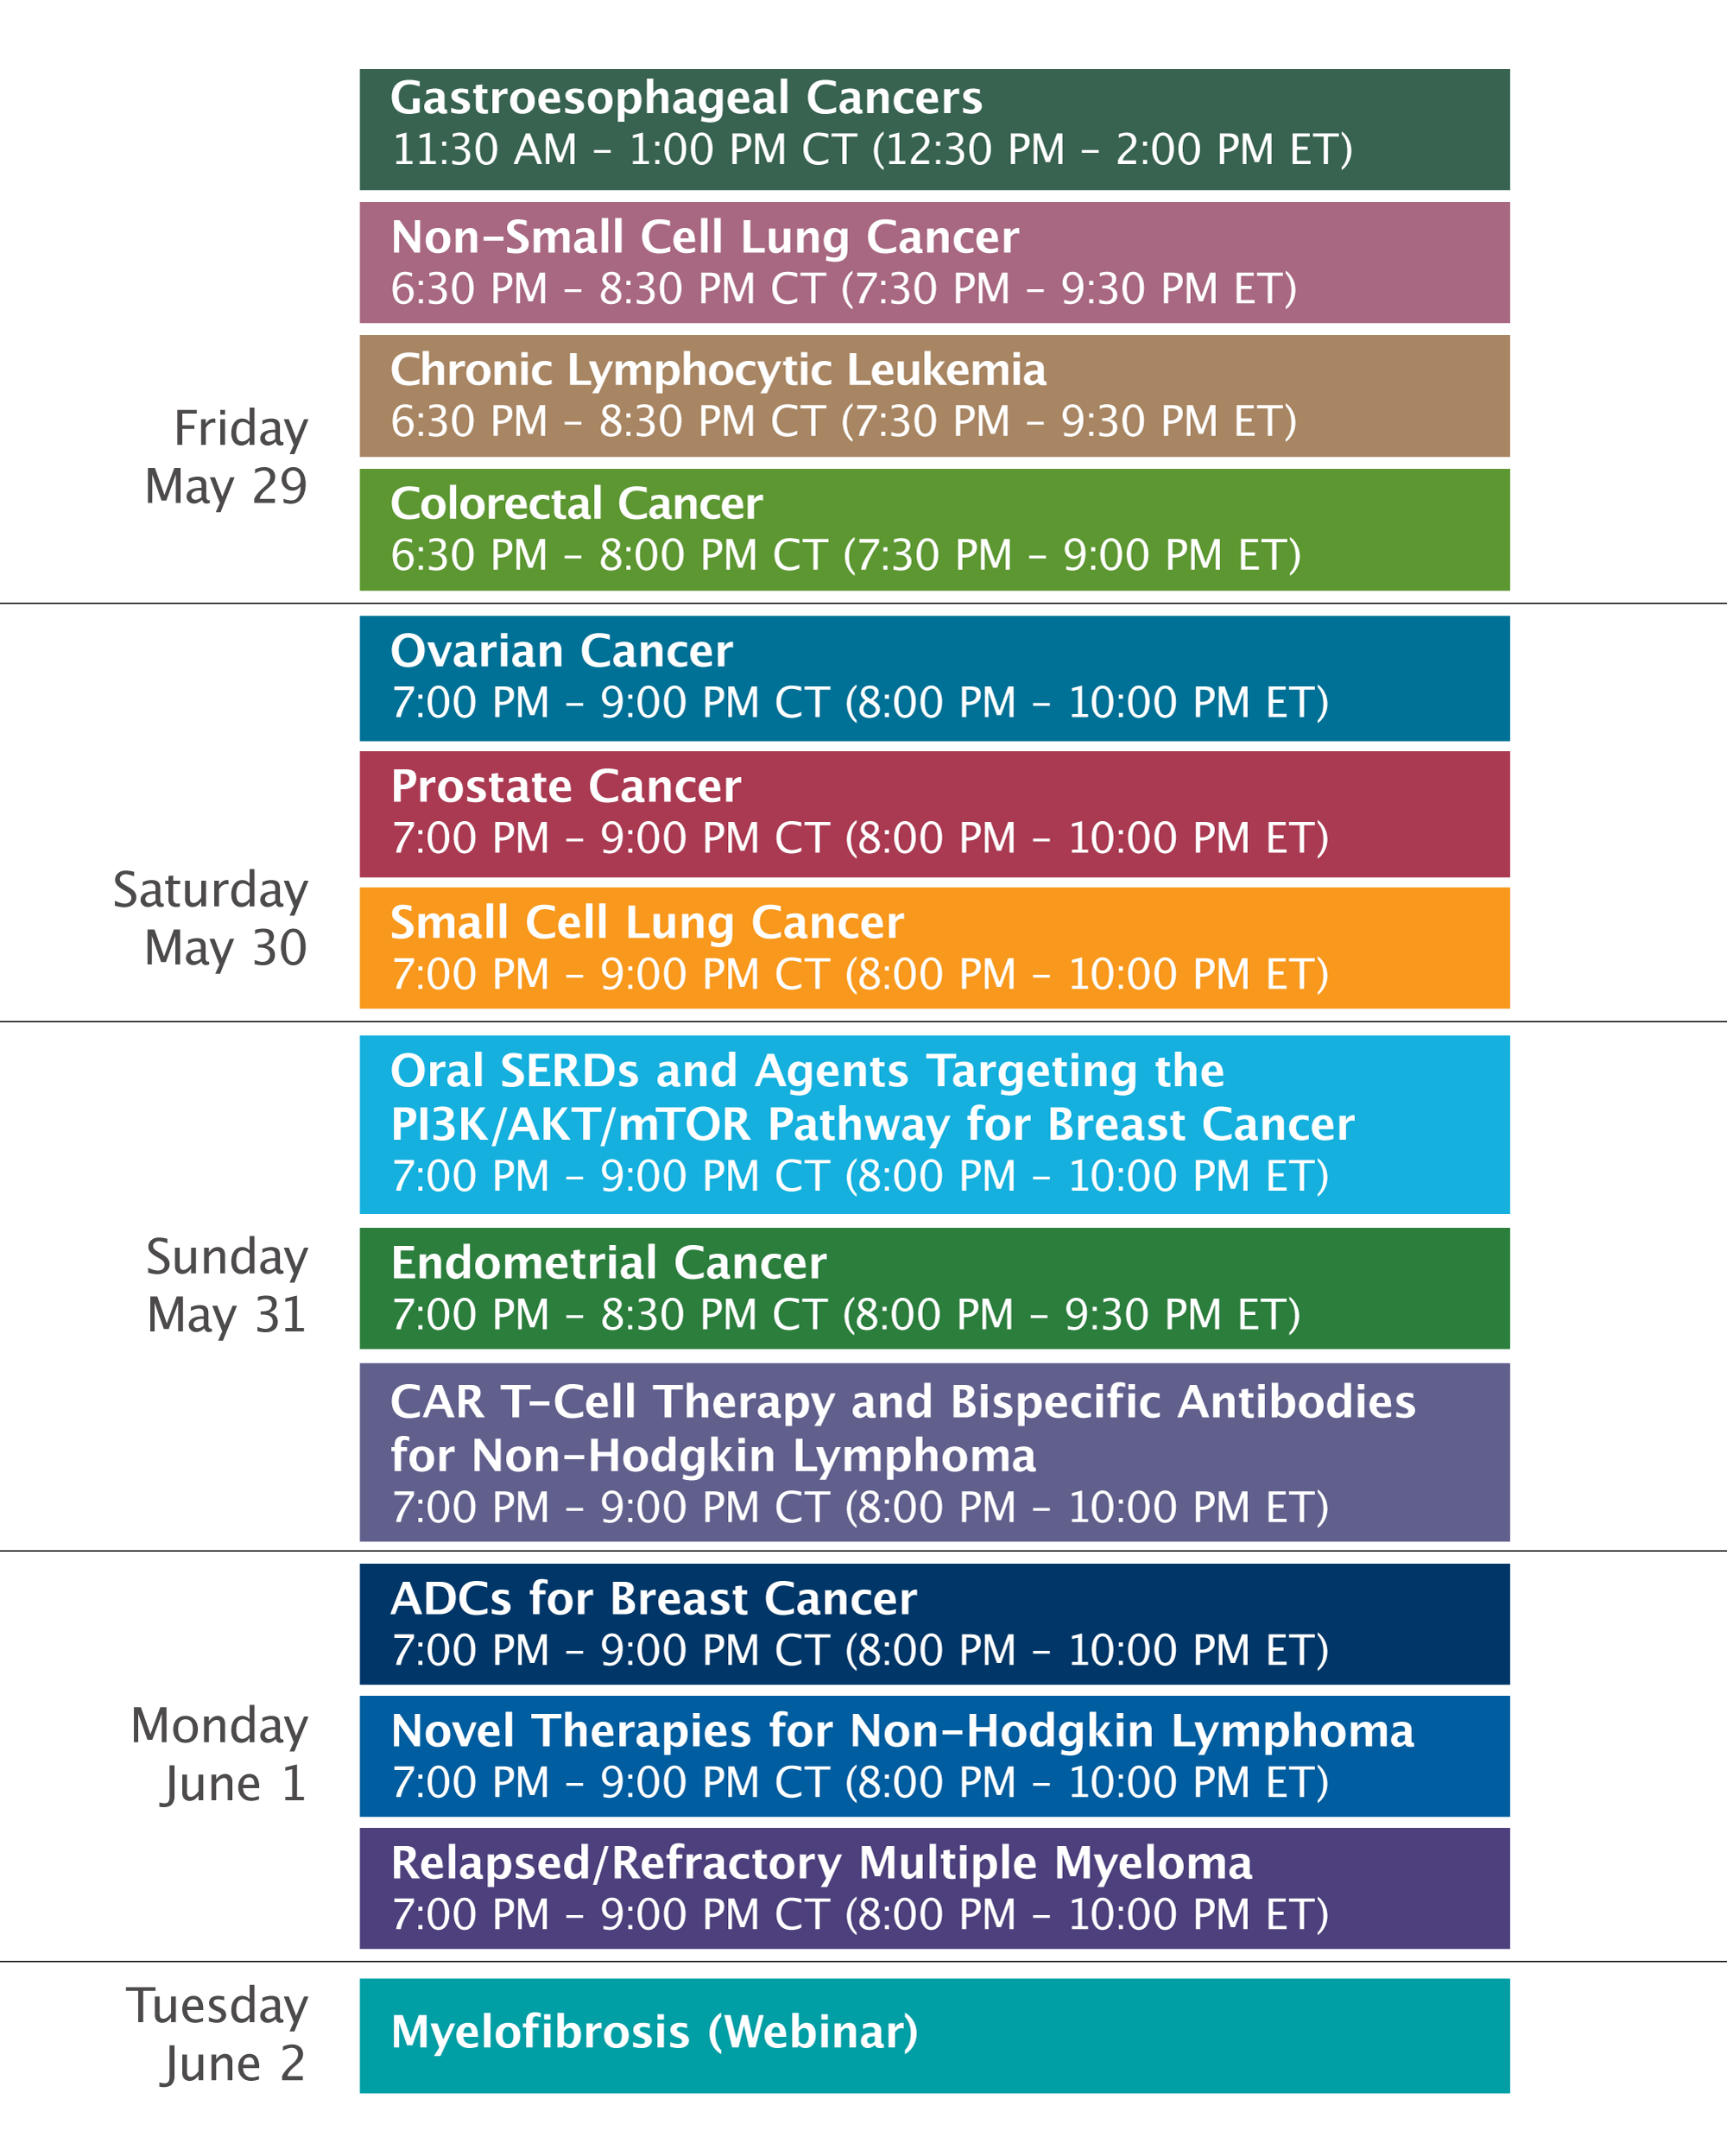

Slide 15
Cases from the Community: Investigators Discuss the Optimal Management of Chronic Lymphocytic Leukemia
Friday, May 29, 2026 6:30 PM – 8:30 PM CT (7:30 PM – 9:30 PM ET)
Faculty
John N Allan, MD
Bita Fakhri, MD, MPH
Shuo Ma, MD, PhD
Mazyar Shadman, MD, MPH
Moderator
Jeremy S Abramson, MD, MMSc

Slide 16
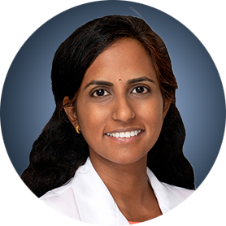


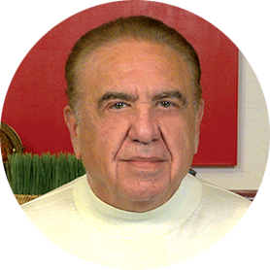
Cases from the Community
Susmitha Apuri, MD
Florida Cancer Specialists & Research Institute
Inverness and Lecanto, Florida
Priya Rudolph, MD, PhD
Georgia Cancer Specialists
Northside Hospital Cancer Institute
Athens, Georgia
Stephen "Fred" Divers, MD
Chief Medical Officer
American Oncology Network
Hot Springs, Arkansas
Neil Love, MD Research To Practice Miami, Florida

Slide 17
Agenda
Module 1: Current and Future Role of Continuous Bruton Tyrosine Kinase (BTK) Inhibitor Therapy for Previously Untreated Chronic Lymphocytic Leukemia (CLL) — Dr Fakhri
Module 2: Available and Emerging Approaches to Time-Limited Therapy for Treatment-Naïve CLL — Dr Allan
Module 3: Optimal Management of Adverse Events (AEs) with BTK and Bcl-2 Inhibitors; Considerations for Special Patient Populations — Dr Ma
Module 4: Selection and Sequencing of Therapy for R/R CLL — Dr Shadman
Module 5: Chimeric Antigen Receptor (CAR) T-Cell Therapy and Other Novel Strategies for CLL — Dr Abramson

Slide 18
Agenda
Module 1: Current and Future Role of Continuous Bruton Tyrosine Kinase (BTK) Inhibitor Therapy for Previously Untreated Chronic Lymphocytic Leukemia (CLL) — Dr Fakhri
Module 2: Available and Emerging Approaches to Time-Limited Therapy for Treatment-Naïve CLL — Dr Allan
Module 3: Optimal Management of Adverse Events (AEs) with BTK and Bcl-2 Inhibitors; Considerations for Special Patient Populations — Dr Ma
Module 4: Selection and Sequencing of Therapy for R/R CLL — Dr Shadman
Module 5: Chimeric Antigen Receptor (CAR) T-Cell Therapy and Other Novel Strategies for CLL — Dr Abramson

Slide 19
BTK Inhibitor Updates in Frontline CLL
Bita Fakhri, MD, MPH
Associate Professor of Medicine
Stanford University
May 29, 2026

Slide 20
Learning Objectives
Updates in continuous covalent BTK Inhibitor Therapy
Updates in continuous non-covalent BTK Inhibitor Therapy

Slide 21
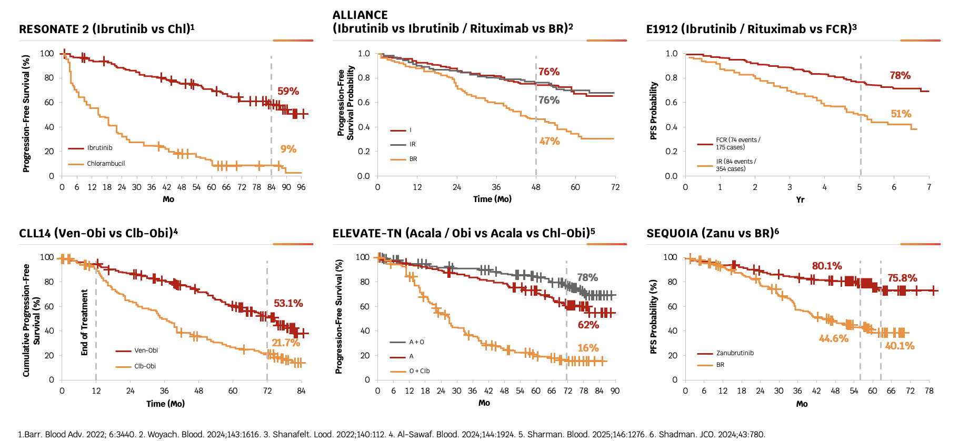
Transformation of Frontline Treatment Landscape in One Decade
Blood.

Slide 22
Most Recent Updates in Continuous BTK Inhibitor Therapy
Frontline
Resonate-2
ELEVATE-TN (acalabrutinib)
SEQUOIA (zanubrutinib)
Relapsed/refractory
Alpine
ELEVATE-RR

Slide 23
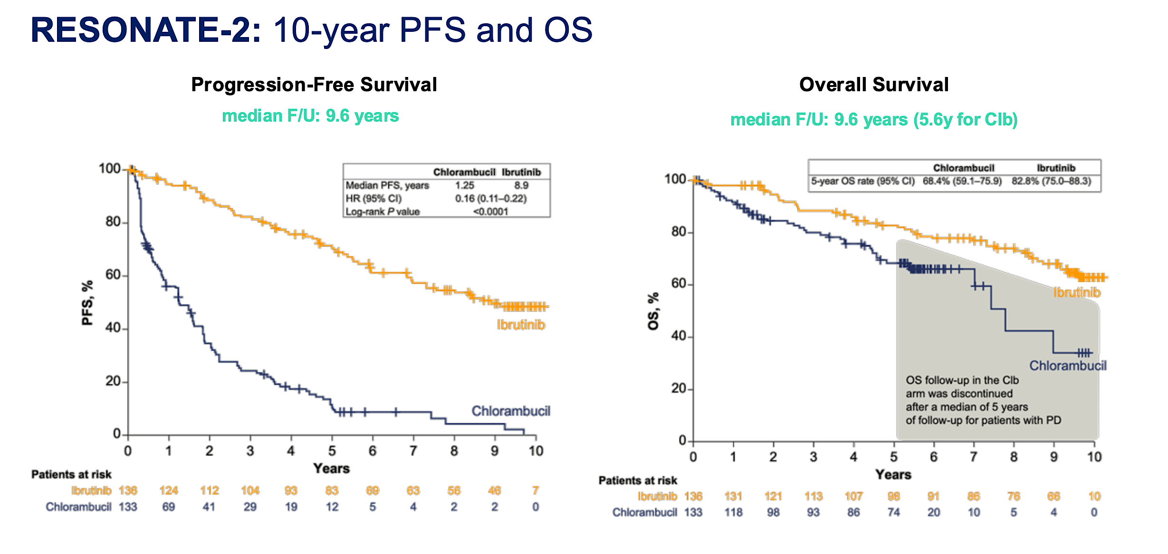
Burger JA et al. Blood 2025;146:2168-2176

Slide 24
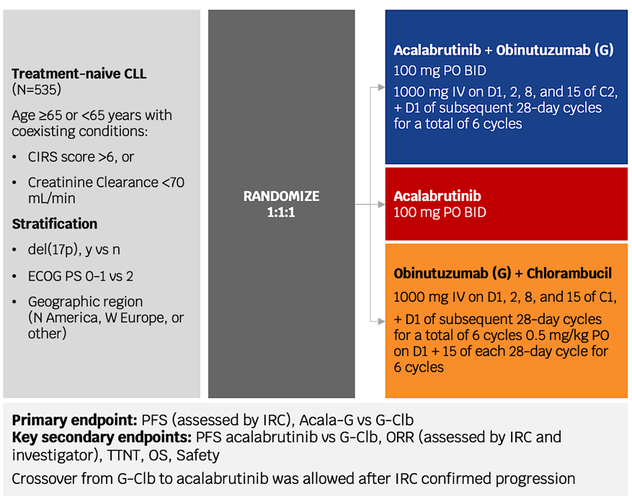
ELEVATE-TN 6 Year Follow-Up
Sharman et al Blood 2023; Sharman et al Blood 2025

Slide 25
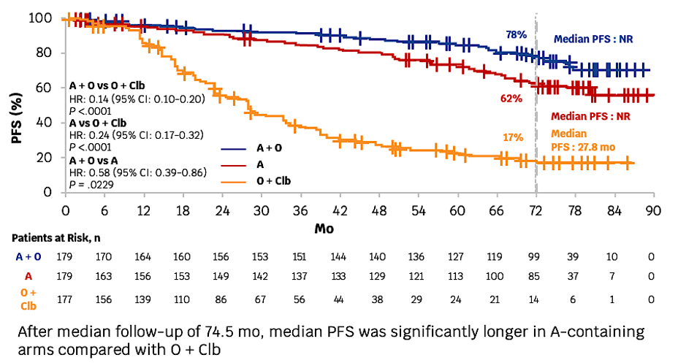
Median PFS was significantly longer for A-containing arms vs O+Clb
Sharman et al Blood 2025

Slide 26
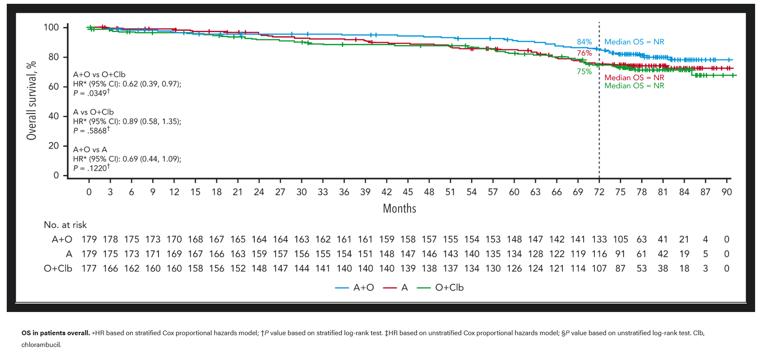
Median OS was significantly longer for A+O vs O+Clb
Sharman et al Blood 2025

Slide 27
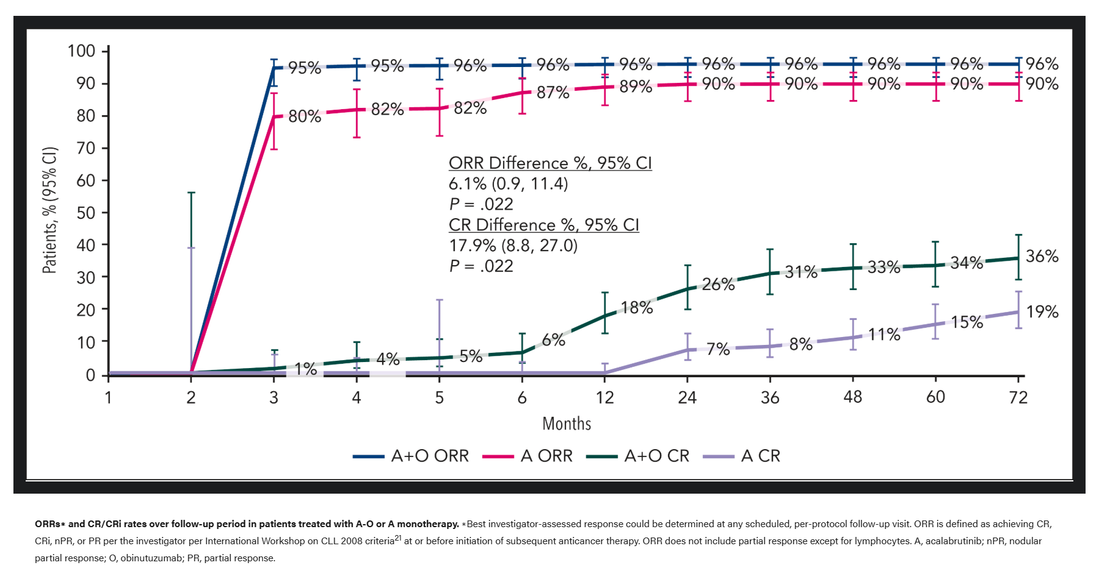
CR rate consistently improved over time
Sharman et al Blood 2025

Slide 28
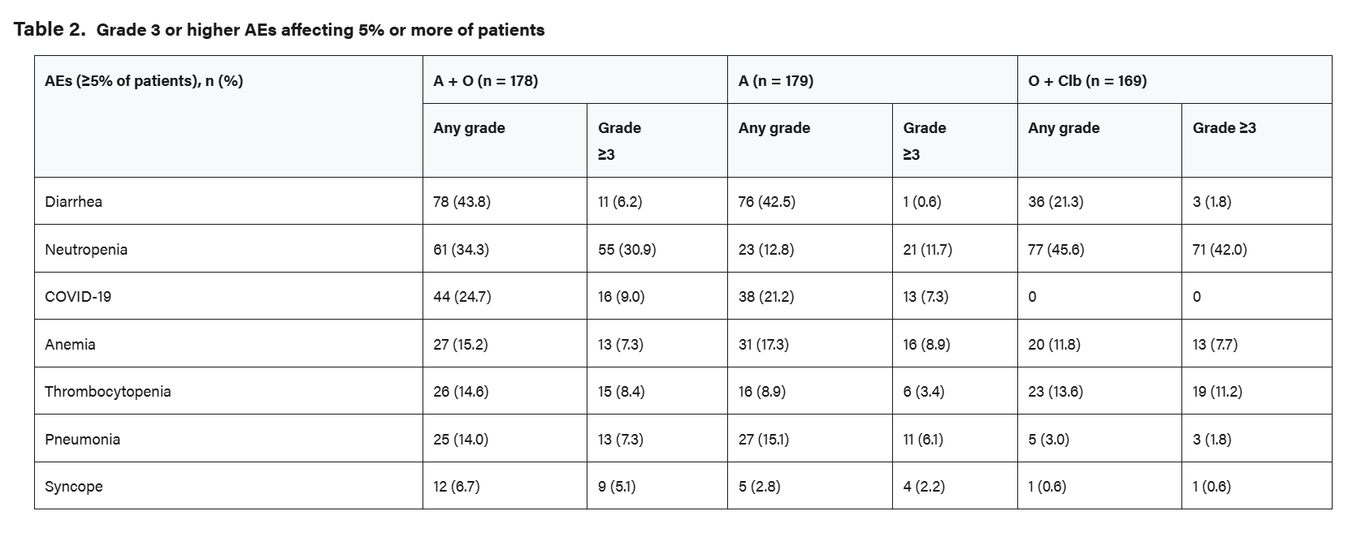
ELEVATE-TN: Safety Profile
Sharman et al Blood 2025

Slide 29
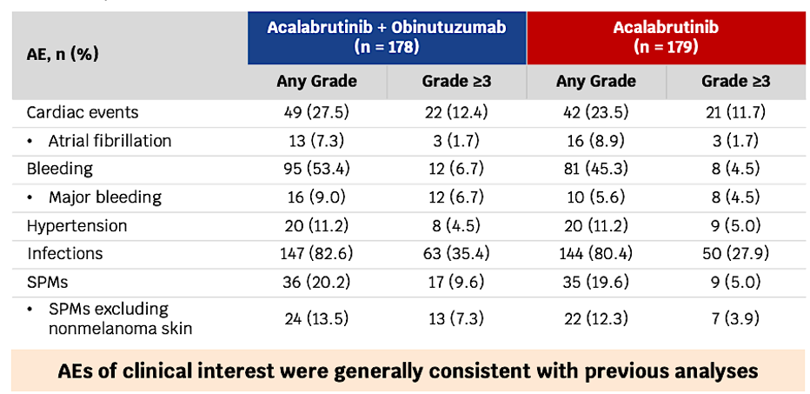
ELEVATE-TN: AEs of Special Interest
Sharman et al Blood 2025

Slide 30
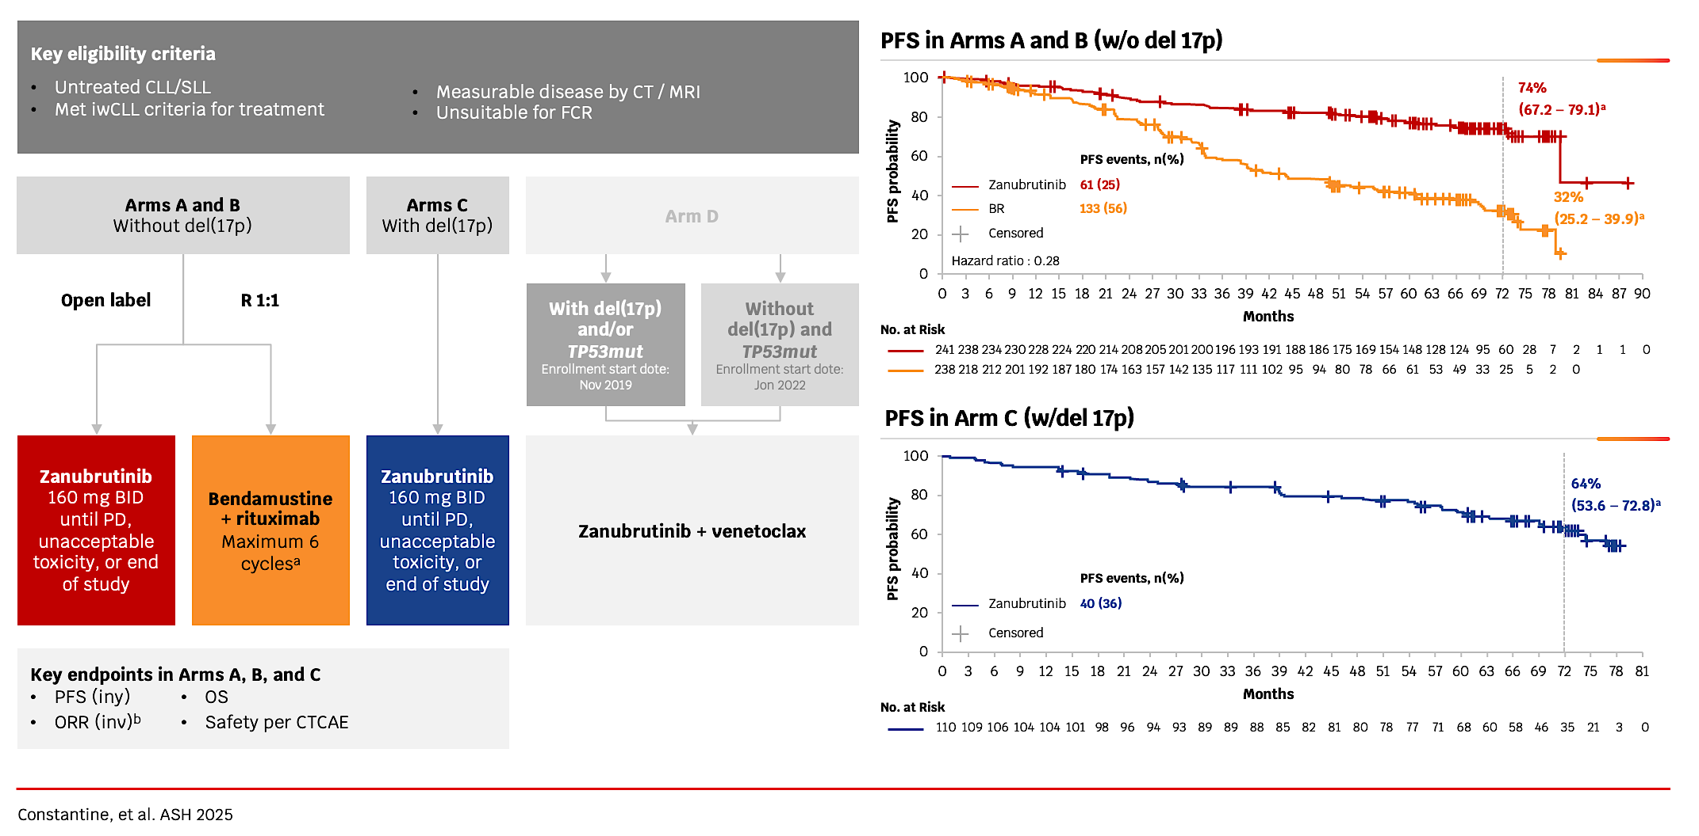
SEQUOIA 6 Year Follow-up by 17p Deletion

Slide 31
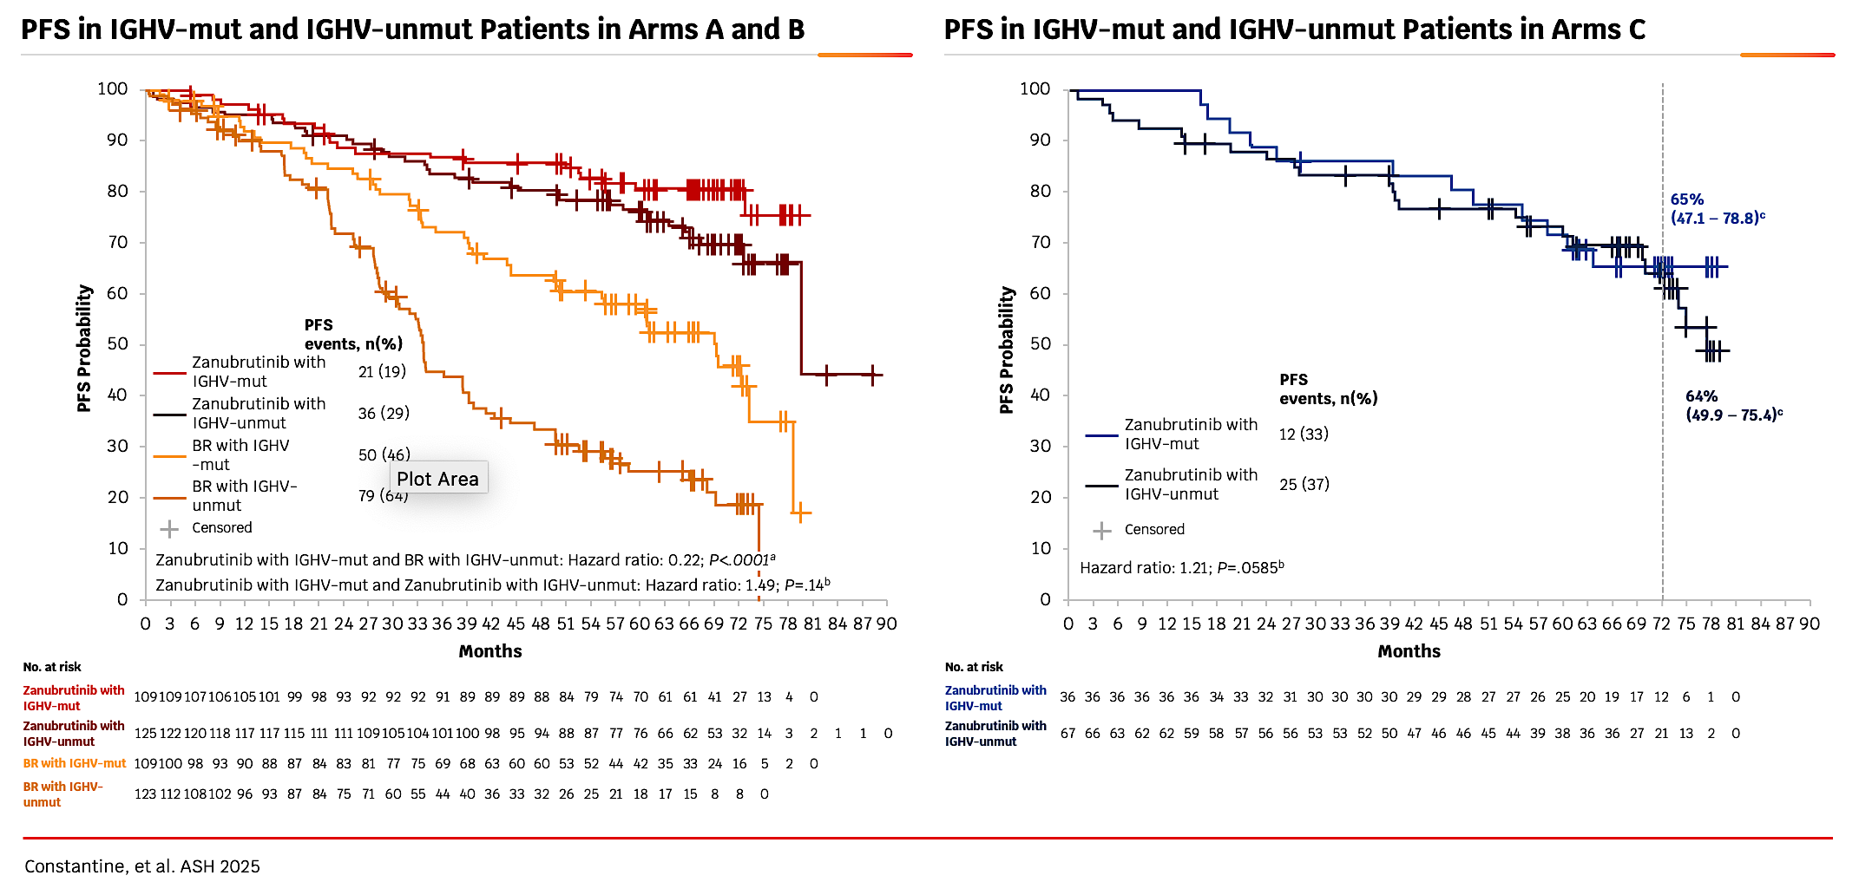
SEQUOIA: Outcomes by Del(17p) and IGHV Mutation Status
50 (46)
79 (64)

Slide 32
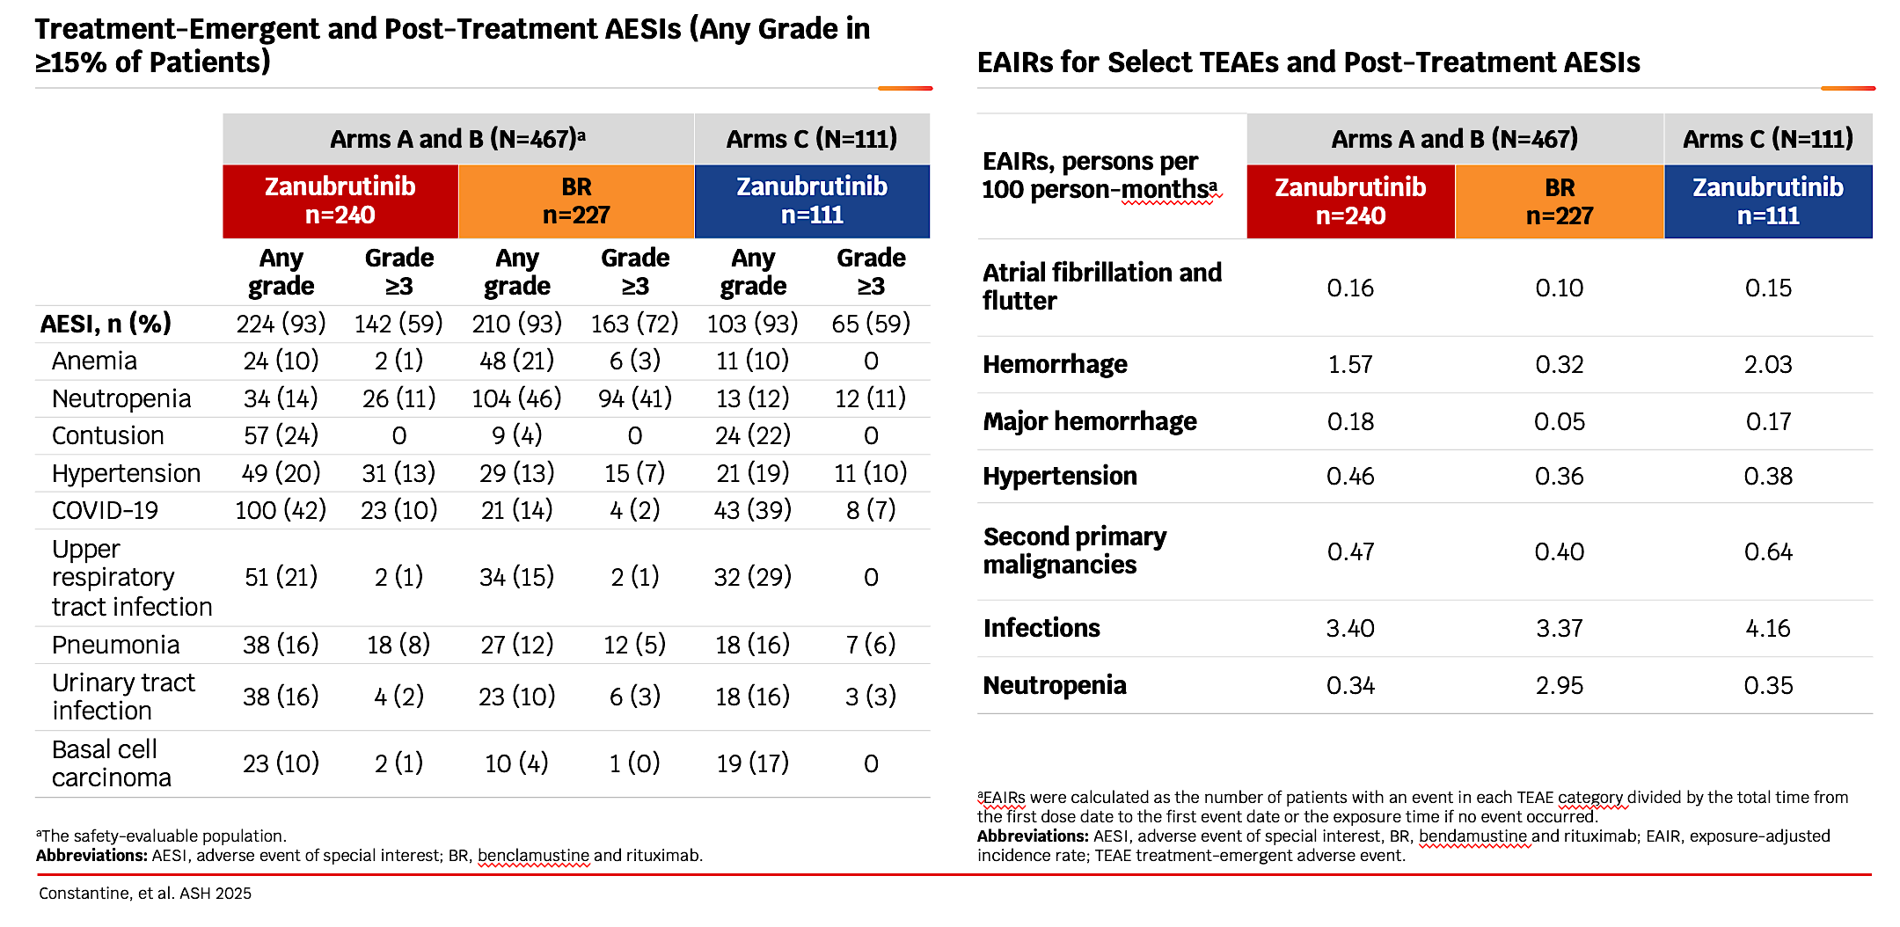
SEQUOIA: Safety Profile

Slide 33
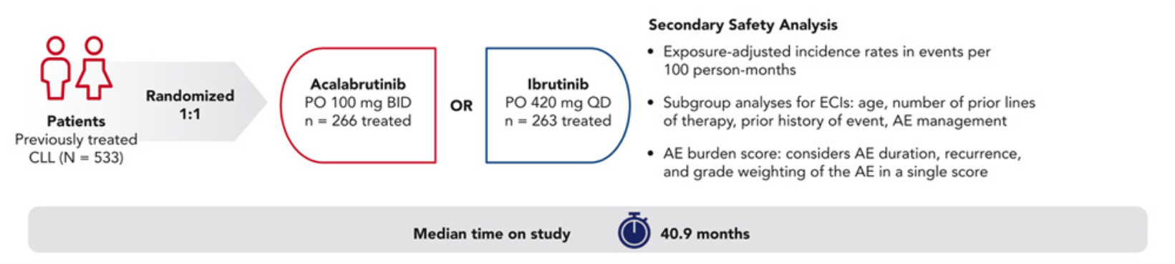
ELEVATE-RR Study Design
Seymour et al. Blood 2023;142:687-699

Slide 34
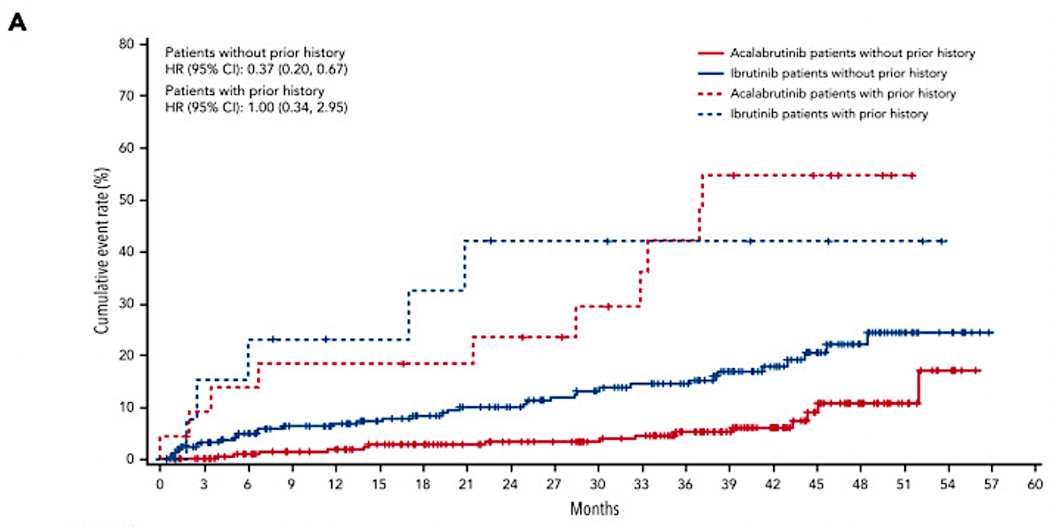
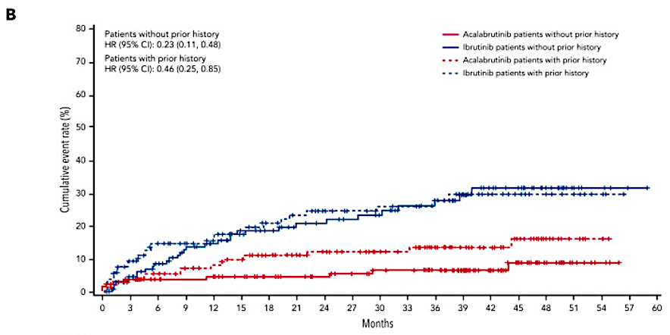
ELEVATE-RR: Adverse Events of Interest
Atrial Fibrillation/Flutter
Hypertension
Seymour et al. Blood 2023;142:687-699

Slide 35
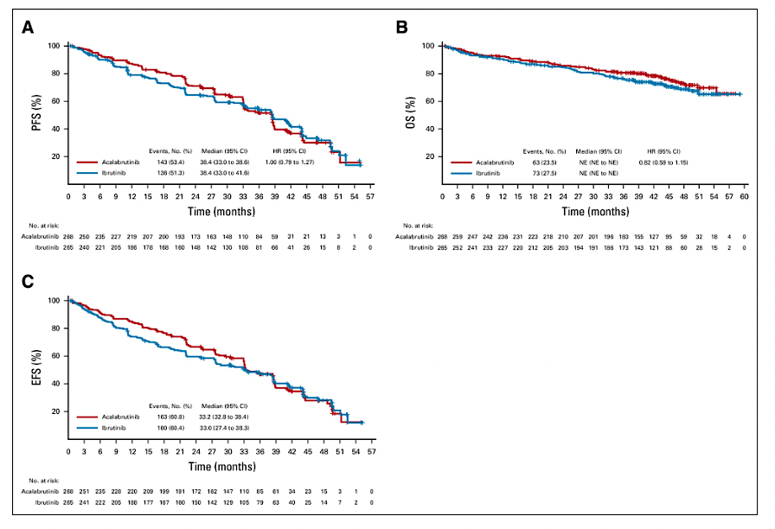
ELEVATE-RR: Acalabrutinib vs Ibrutinib in Rel/Ref CLL
Byrd et al. JCO 2021;39(31):3441-3452

Slide 36
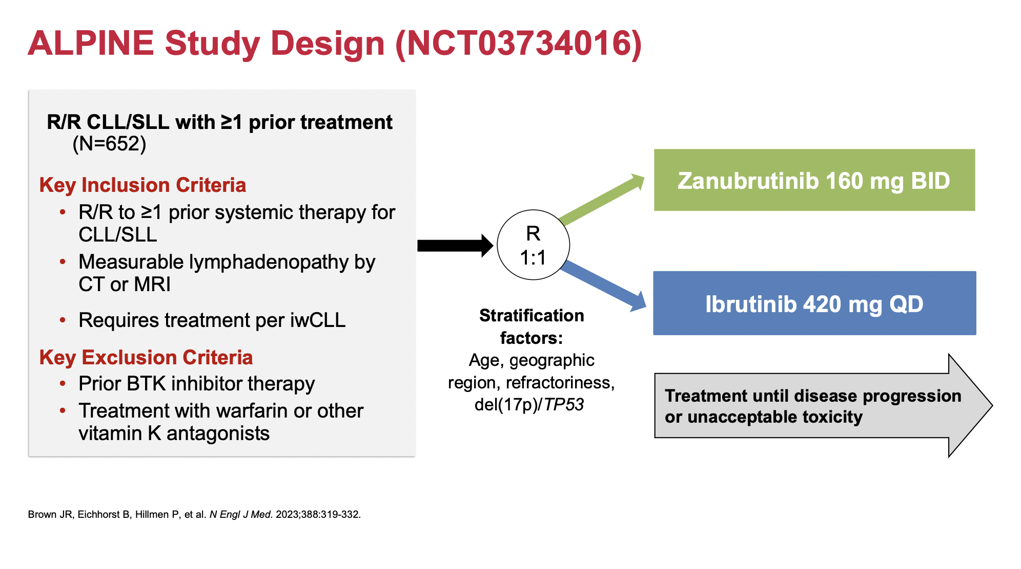
Brown JR et al. ASH 2023

Slide 37
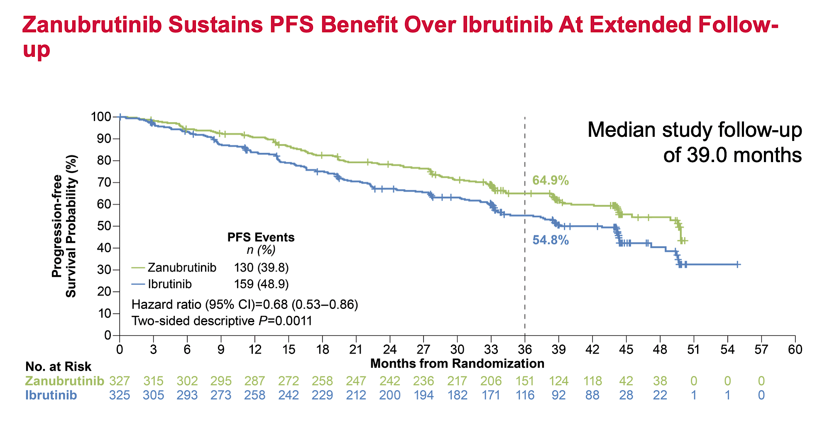
Brown JR et al. ASH 2023

Slide 38
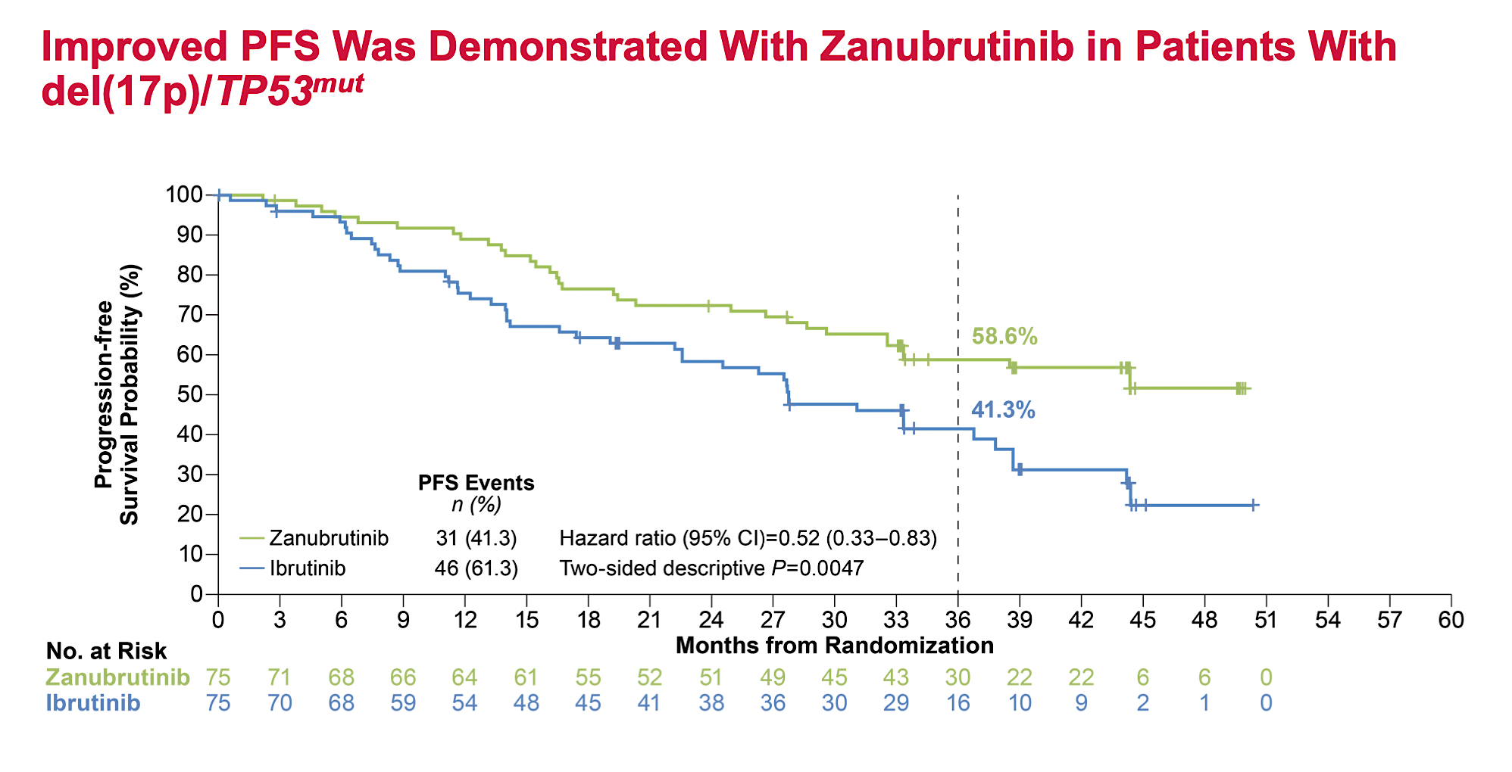
Brown JR et al. ASH 2023

Slide 39
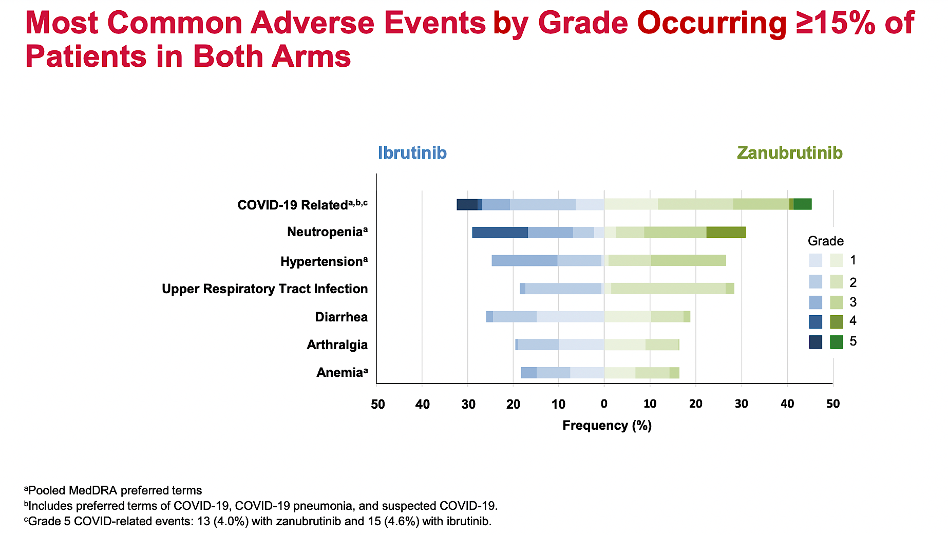
in ≥15% of
Brown JR et al. ASH 2023

Slide 40
Non-Covalent BTK Inhibitors in Frontline CLL
Bruin CLL-314 trial
Bruin CLL-313 trial

Slide 41
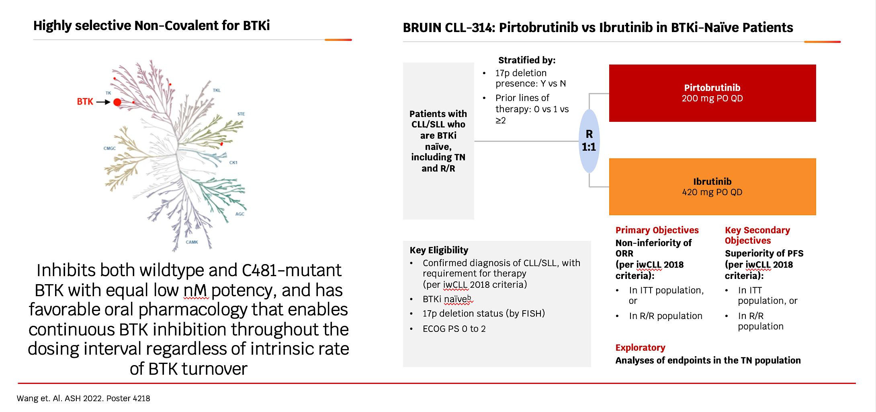
BRUIN CLL 314: Pirtobrutinib vs Ibrutinib in BTKi‑Naïve Patients

Slide 42
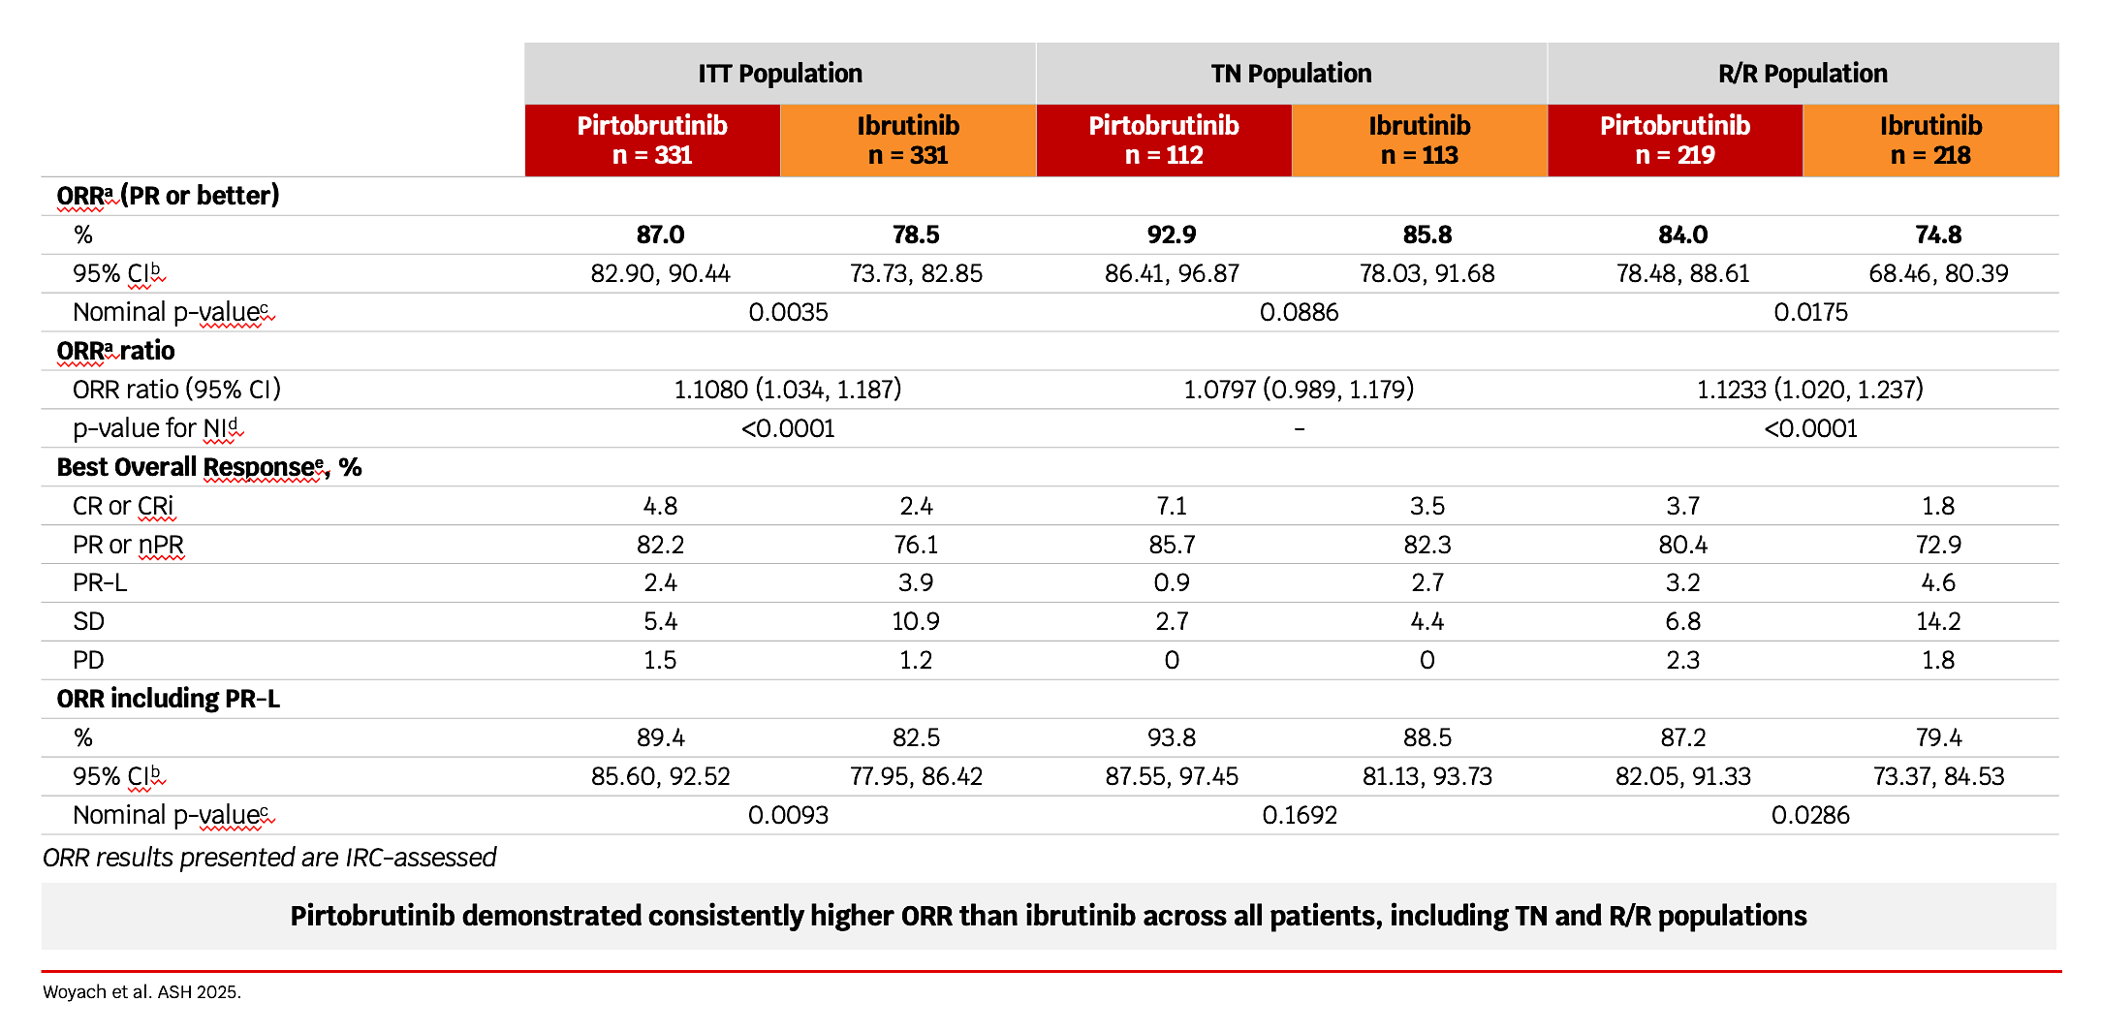
Bruin CLL-314 Response Rates

Slide 43
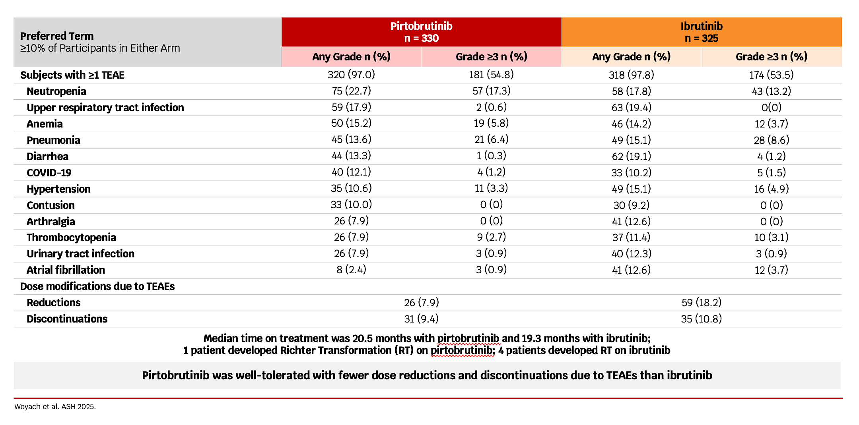
Bruin CLL-314 Safety Profile

Slide 44
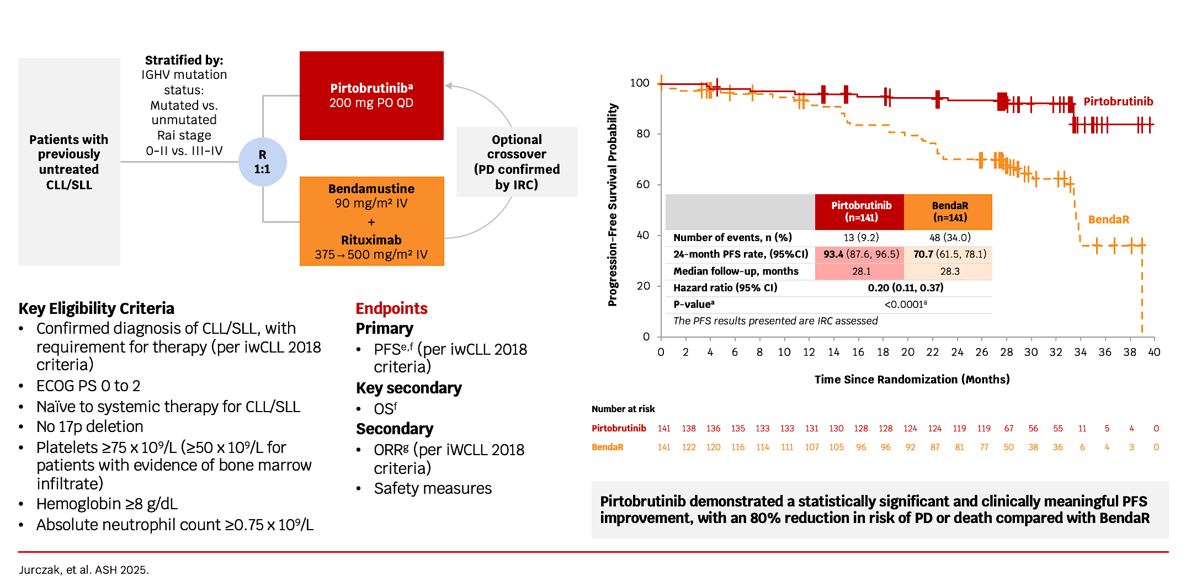
Bruin CLL-313: Pirtobrutinib vs. Chemoimmunotherapy

Slide 45
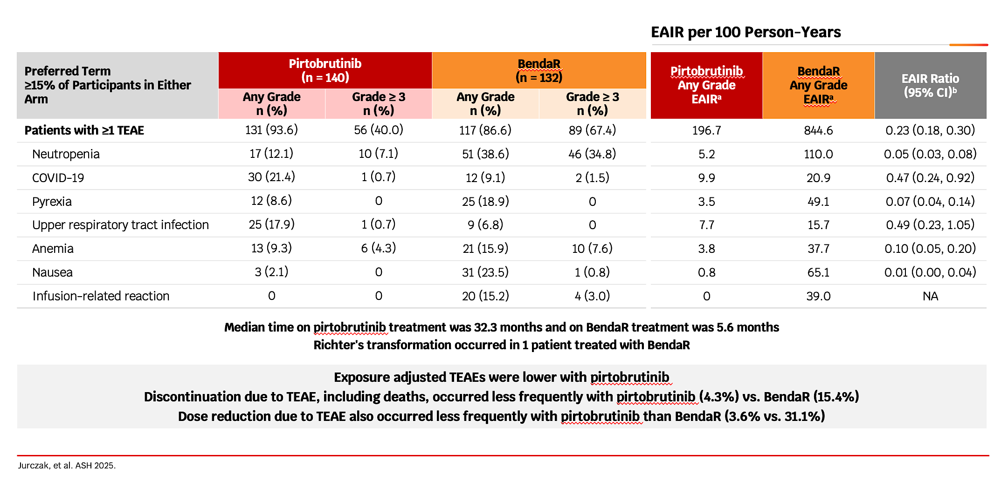
Bruin CLL-313: Safety Profile

Slide 46
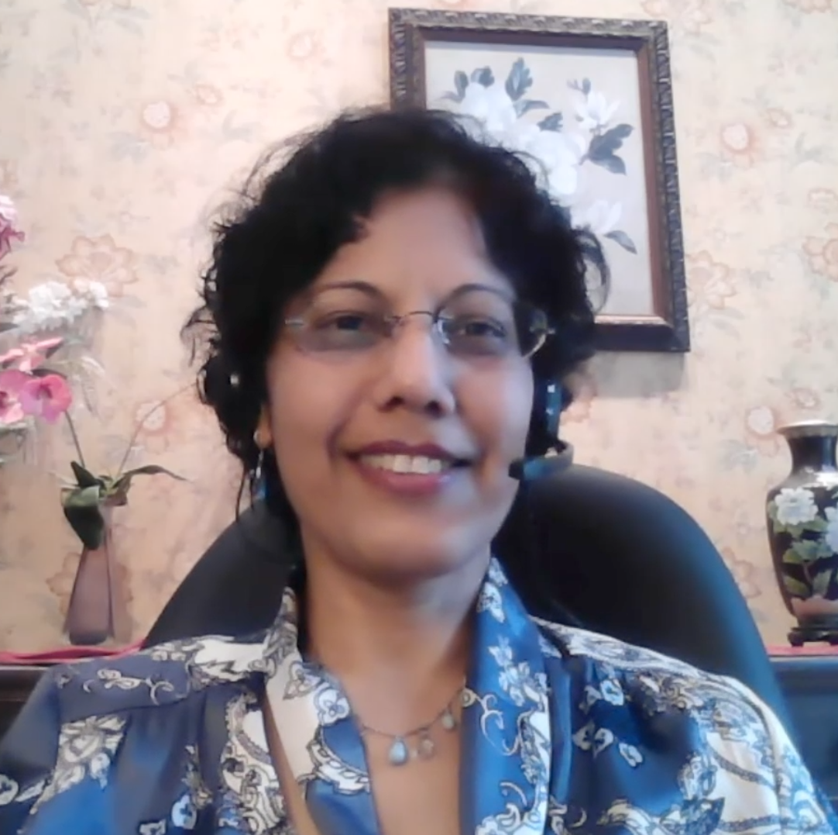
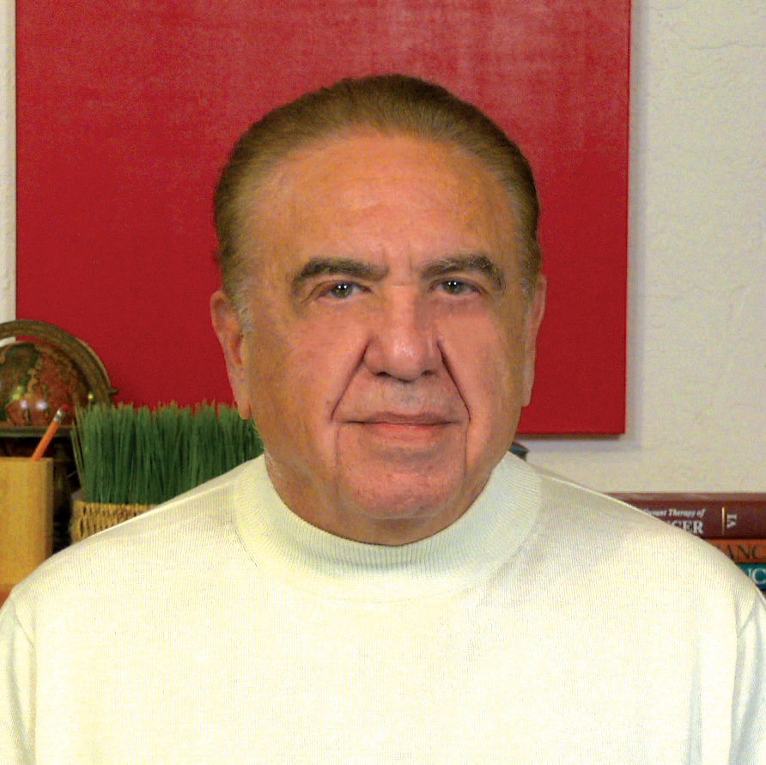
Cases from the Community
Priya Rudolph, MD, PhD
Neil Love, MD

Slide 47
Discussion Questions
For a patient who is otherwise asymptomatic, do you use the tempo of leukocytosis/lymphocytosis to determine whether to initiate active therapy?
Is there a specific lymph node size or time to doubling of lymph node size that would prompt you to start treatment?
If this patient had high-risk features such as del(17p) or a TP53 mutation, would that have prompted you to initiate treatment any earlier?
For patients with CLL to whom you administer a covalent BTK inhibitor as initial therapy, do you have a preference for a specific one? How do you choose between acalabrutinib and zanubrutinib in this setting?

Slide 48
Agenda
Module 1: Current and Future Role of Continuous Bruton Tyrosine Kinase (BTK) Inhibitor Therapy for Previously Untreated Chronic Lymphocytic Leukemia (CLL) — Dr Fakhri
Module 2: Available and Emerging Approaches to Time-Limited Therapy for Treatment-Naïve CLL — Dr Allan
Module 3: Optimal Management of Adverse Events (AEs) with BTK and Bcl-2 Inhibitors; Considerations for Special Patient Populations — Dr Ma
Module 4: Selection and Sequencing of Therapy for R/R CLL — Dr Shadman
Module 5: Chimeric Antigen Receptor (CAR) T-Cell Therapy and Other Novel Strategies for CLL — Dr Abramson

Slide 49
Available and Emerging Approaches to Time-Limited Therapy for Treatment-Naïve CLL
Research To Practice
ASCO 2026 Satellite Symposium
Chicago, IL, May 29, 2026
John N. Allan
Associate Professor of Clinical Medicine
Weill Cornell

Slide 50
Learning Objectives
Incorporate Long-term data with up-front venetoclax/obinutuzumab for CLL
Review mechanistic rationale for combining BTK inhibitors and venetoclax with and without anti-CD20 antibodies for CLL
Learn about the efficacy and safety findings from the Phase III CLL17 trial comparing continuous BTK inhibition versus time-limited venetoclax-based doublets
Evaluate published findings from the Phase III AMPLIFY trial of fixed-duration acalabrutinib in combination with venetoclax with or without obinutuzumab for previously untreated CLL
Identify other combinations reviewing early data with zanubrutinib in combination with Bcl-2 inhibitors (eg, venetoclax, sonrotoclax) with or without an anti-CD20 antibody in treatment-naïve CLL

Slide 51
Shifting Trends in Management of Frontline CLL
Treat to Progression
Fixed Duration or MRD-Guided Therapy
~1-year time-limited therapy (MRD-guided may extend 1-2 years or longer)
Mitigated cardiac risks by discontinuation or use of second-generation BTKi
Less concern over long-term adherence
Potential for cost savings
Time intensive (infusions possible, venetoclax ramp-up monitoring)
Ideal Patient type for Oral Doublet vs Triplet vs. Ven-G or MRD-guided therapy is not defined (possible benefit of Triplet over Doublet in IGHV unmutated)
Convenience (no infusions or TLS monitoring)
Longer-term efficacy data (movement towards second-generation selective agents)
Survival advantage compared to chemoimmunotherapy
Improves versus diminishes immune function
Does not cause clonal hematopoiesis
Indefinite treatment
Potential for cumulative cardiac toxicity
BTKi, Bruton’s tyrosine kinase inhibitor; CLL, chronic lymphocytic leukemia; IGHV, immunoglobulin heavy-chain variable region gene; MRD, measurable residual disease; TLS, tumor lysis syndrome; Ven-G, venetoclax, obinutuzumab; vs, versus.
NCCN Clinical Practice Guidelines in Oncology (NCCN Guidelines®) for Guideline Name Chronic Lymphocytic Leukemia/Small Lymphocytic Lymphoma V.2.2026. © 2026 National Comprehensive Cancer Network, Inc. All rights reserved.

Slide 52
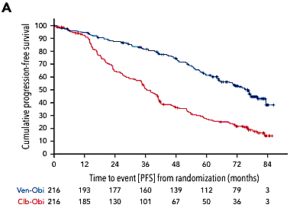
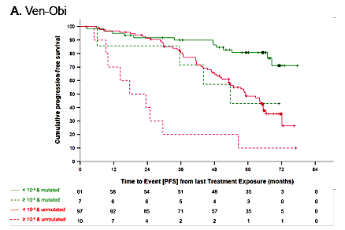
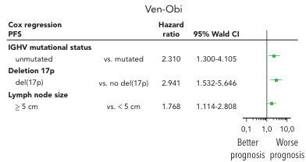
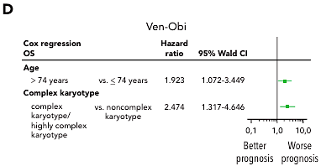
What Have We Learned from CLL14 about our Standard FD Regimen?
PFS
PFS if MRD- vs Not
PFS Multivariate Analysis
Only 8% remain uMRD at 60 months
80% had mutated IGHV
OS Multivariate Analysis
Al Sawaf et al Blood (2024) 144 (18): 1924–1935.

Slide 53
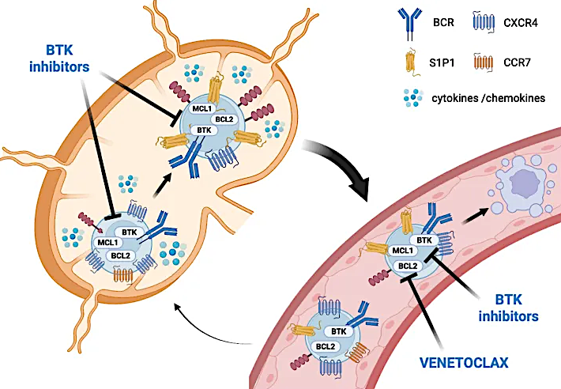
Mechanistic Rationale of Potential Synergies of BTK/BCL2 Dual Inhibition
Visetin and Mauro Oncol. Rev., 17 December 2025

Slide 54
CLL17: Phase 3 Trial of Continuous Ibrutinib Monotherapy vs Fixed-Duration Venetoclax-Based Regimens as First-Line Treatments for CLL
Ibrutinib 420 mg PO daily until PD
Key Eligibility Criteria
Patients with previously untreated CLL
ECOG PS 0-2
Absolute neutrophil count ≥1.0 x 10⁹/L
Platelet counts ≥30 x 10⁹/L
Total haemoglobin ≥8 g/dL
n = 301
Primary Endpoints
Investigator-assessed PFS
Key Secondary Endpoints
Minimal residual disease Response OS Safety
Venetoclax 400 mg PO daily (C1D22 to C12)
Obinutuzumab 1000 mg IV (C1D1(2)/8/15, C2-6D1)
R
n = 303
Venetoclax 400 mg PO daily (C4D1 to C15)
Ibrutinib 420 mg PO daily (C1D1 to C15)
n = 305
976 patients screening in 174 sites, across 13 countries
Patient enrollment from February 2021 to November 2022
Median observation time: 34.2 months (IQR 30.3-39.3)
CLL, chronic lymphocytic leukemia; ECOG PS, Eastern Cooperative Oncology Group Performance Status; IQR, interquartile range; IV, intravenous; PD, progressive disease; PFS, progression-free survival; PO, oral administration; OS, overall survival.
Al-Sawaf, et al. N Engl J Med. Published online December 6, 2025. doi:10.1056/NEJMoa2515458
*Venetoclax + ibrutinib is not yet FDA-approved

Slide 55
CLL17: Response to Treatment
iwCLL Response at
Final Restaging (C18D1)
uMRD <10⁻⁴ in Peripheral Blood and Bone Marrow, by Flow Cytometry, at Final Restaging
100
84.2%
88.5%
86%
100
73.3%
222/303
75
62%
188/303
PR: 32.7
PR: 42.3
Response Type
75
47.2%
144/305
50
Partial response
40%
122/305
Patients w/ Response (%)
PR: 77.7
50
Peripheral blood
Complete Response
Percentage of Patients
Bone marrow
25
CR: 51.5
CR: 46.2
25
CR: 8.3
0%
0/301
0%
0/301
0
Venetoclax-Obinutuzumab
Venetoclax-Ibrutinib
Ibrutinib
0
Venetoclax-Obinutuzumab
Venetoclax-Ibrutinib
Ibrutinib
iwCLL, international workshop on CLL; uMRD, undetectable measurable residual disease.
Al-Sawaf, et al. N Engl J Med. Published online December 6, 2025. doi:10.1056/NEJMoa2515458
*Venetoclax + ibrutinib is not yet FDA-approved

Slide 56
CLL17: Survival Across Treatment Arms
PFS by Treatment Arm
OS by Treatment Arm
100
3-year PFS
VO 81.1%
I 81.0%
VI 79.4%
100
3-year OS
VO 91.5%
I 95.7%
VI 96.0%
80
80
60
60
PFS (%)
OS (%)
40
VI vs I: HR 0.84;
type-I-error adjusted CI [98.0%] 0.53-1.32
VO vs I: HR 0.87;
type-I-error adjusted CI [98.3%] 0.54-1.41
40
20
20
VI vs I: HR 0.96; 95% CI 0.45-2.05
VO vs I: HR 1.67; 95% CI 0.86-3.28
0
0
0
12
24
36
48
0
12
24
36
48
Time Since Randomization (months)
Time Since Randomization (months)
No. at risk
VO
VI
I
No. at risk
VO
VI
I
303
305
301
278
278
267
256
267
243
77
82
94
0
0
1
303
305
301
284
281
284
269
279
276
102
114
141
0
1
2
Cause of death | VO | I | VI
Infection | 12 (7 Covid) | 3 | 7 (2 Covid)
Cardiovascular | 5 | 5 | 3
PD/RT | 1 | 0 | 0
SPM | 4 | 2 | 2
Other | 0 | 4 | 1
Total | 22 | 14 | 13
 | VO | I | VI
PD | 25 | 46 | 37
Death | 21 | 11 | 13
Fixed-duration treatment with venetoclax–obinutuzumab or venetoclax–ibrutinib was noninferior to continuous ibrutinib with regards to investigator-assessed PFS.
CI, confidence interval; CLL, chronic lymphocytic leukemia; HR, hazard ratio; I, ibrutinib; no. number; OS, overall survival; PD, progressive disease; PD/RT, progressive disease/Richter transformation; PFS, progression-free survival; SPM, second primary malignancies; VI, venetoclax–ibrutinib; VO, venetoclax–obinutuzumab.
Al-Sawaf, et al. N Engl J Med. Published online December 6, 2025. doi:10.1056/NEJMoa2515458
*Venetoclax + ibrutinib is not yet FDA-approved

Slide 57
CLL17: PFS According to IGHV and TP53/del17p Status
PFS According to IGHV status
PFS According to TP53/del17p status
100
3-year PFS
100
3-year PFS
80
I, uIGHV 79.7%
I, mIGHV 83.5%
VI, uIGHV 78.9%
VI, mIGHV 80.0%
VO, uIGHV 75.8%
VO, mIGHV 87.6%
80
I, TP53del/mut 79.4%
I, TP53-WT 81.0%
VI, TP53del/mut 69.0%
VI, TP53-WT 80.1%
VO, TP53del/mut 62.0%
VO, TP53-WT 82.7%
60
Unmutated IGHV
VI vs I: HR 0.81;
95% CI 0.49-1.32
VO vs I: HR 0.98;
95% CI 0.61-1.59
60
TP53 del/mut
VI vs I: HR 0.70;
95% CI 0.22-2.16
VO vs I: HR 1.20;
95% CI 0.40-3.59
PFS (%)
PFS (%)
40
40
20
20
0
0
0
12
24
36
48
0
12
24
36
48
Time since Randomization (months)
Time since Randomization (months)
No. at risk
VO, unmutated
VO, mutated
VI, unmutated
VI, mutated
I, unmutated
I, mutated
No. at risk
VO, del/mut
VO, WT
VI, del/mut
VI, WT
I, del/mut
I, WT
171
129
172
129
171
126
156
119
157
117
156
108
142
111
151
112
145
95
40
36
50
32
55
37
0
0
0
0
1
0
23
280
25
279
21
279
21
257
20
257
19
247
16
240
18
248
15
227
5
72
4
78
7
87
0
0
0
0
0
1
CI, confidence interval; CLL, chronic lymphocytic leukemia; HR, hazard ratio; I, ibrutinib; IGHV, immunoglobulin heavy-chain variable region gene; mIGHV, mutated IGHV; PFS, progression-free survival; TP53del/mut, TP53 deletion and/or mutation; uIGHV, unmutated IGHV; VI, venetoclax–ibrutinib; VO, venetoclax–obinutuzumab; WT, wild type.
Al-Sawaf, et al. N Engl J Med. Published online December 6, 2025. doi:10.1056/NEJMoa2515458
*Venetoclax + ibrutinib is not yet FDA-approved

Slide 58
CLL17: Selected Adverse Events of Interest
 | VO | VI | I
Safety population – n (%) | 295 | 303 | 298
Blood and lymphatic system disorders | 174 (59.0) | 130 (42.9) | 85 (28.5)
Febrile neutropenia | 14 (4.7) | 7 (2.3) | 0 (0)
Neutropenia | 155 (52.5) | 110 (36.3) | 49 (16.4)
Cardiac disorders | 41 (13.9) | 72 (23.8) | 103 (34.6)
Atrial fibrillation | 11 (3.7) | 38 (12.5) | 50 (16.8)
Gastrointestinal disorders | 176 (59.7) | 225 (74.3) | 189 (63.4)
Diarrhea | 80 (27.1) | 143 (47.2) | 104 (34.9)
Infections and infestations | 225 (76.3) | 243 (80.2) | 238 (79.9)
COVID-19 | 113 (38.3) | 128 (42.2) | 117 (39.3)
Pneumonia | 41 (13.9) | 28 (9.2) | 40 (13.4)
Metabolism and nutrition disorders | 90 (30.5) | 75 (24.8) | 72 (24.2)
Tumor lysis syndrome | 12 (4.1) | 4 (1.3) | 1 (0.3)
Neoplasms benign, malignant and unspecified | 35 (11.9) | 35 (11.6) | 55 (18.5)
Richter Transformation | 4 (1.4) | 1 (0.3) | 4 (1.3)
Vascular disorders | 60 (20.3) | 102 (33.7) | 124 (41.6)
Hypertension | 34 (11.5) | 51 (16.8) | 72 (24.2)
Grade 3-5 Infections | VO | VI | I
 | 295 | 303 | 298
Infections and infestations | 103 (34.9) | 76 (25.1) | 74 (24.8)
COVID-19 | 47 (15.9) | 26 (8.6) | 20 (6.7)
Pneumonia | 29 (9.8) | 22 (7.3) | 22 (7.4)
Al-Sawaf, et al. N Engl J Med. Published online December 6, 2025. doi:10.1056/NEJMoa2515458
I, ibrutinib; VI, venetoclax–ibrutinib; VO, venetoclax–obinutuzumab.
*Venetoclax + ibrutinib is not yet FDA-approved

Slide 59
AMPLIFY: Firstline Treatment of CLL With Acalabrutinib + Venetoclax^{1,2}
AMPLIFY, randomized, multicenter, open-label, phase 3
Key Inclusion Criteria
Age ≤ 18 years
TN CLL requiring treatment per iwCLL 2018 criteria
Without del(17p) or TP53ª
ECOG PS ≤ 2
Key Exclusion Criteria
CIRS geriatric > 6
Significant cardiovascular disease
Stratification
Age (> 65 vs ≤ 65 years)
IGHV mutational status
Rai stage ≥3 vs < 3
Geographic region
AV (14 cycles)
n = 291
Primary endpoints
IRC-assessed PFS (AV vs FCR/BR)
If primary endpoint is met, secondary endpoints tested in fixed sequential hierarchy
1. IRC-PFS (AVO vs FCR/BR)
2. uMRD (AV vs FCR/BR)
3. uMRD (AVO vs FCR/BR)
4. OS (AV vs FCR/BR)
5. OS (AVO vs FCR/BR)
N = 867
R
1:1:1
AVO (14 cycles)
n = 286
FCR/BR
(6 cycles)
n = 290
AV and AVO
dosing
schedule
Acalabrutinib 100 mg PO BID (cycles 1–14)
Crossover not built into protocol
Venetoclax 400 mg PO QD (cycles 3–14)
Obinutuzumab (AVO only) 1000 mg (cycles 2–7)
Cycles
(28 days each)
1
2
3
4
5
6
7
8
9
10
11
12
13
14
1. Brown JR, et al. Blood. 2024;144 (Supplement 1):1009. 2. Brown JR, et al. N Engl J Med. 2025 Feb 20;392(8):748-762.

Slide 60
AMPLIFY: IRC-Assessed PFS^{1,2}
EOT
34% MRD4 Rate AV
68% MRD4 Rate AVO
100
83.1%
80
76.5%
AVO
60
 | AV vs FCR/BR n = 581 | AVO vs FCR/BR n = 576
HRª (95% CI) P-Value^{b} | 0.65 (0.49–0.87) P = 0.004 | – – P < 0.0001
66.5%
PFS (%)
AV
40
FCR/BR
20
0
0
6
12
18
24
30
36
42
48
54
60
No. at risk
Months
AV
AVO
FCR/BR
291
286
290
282
272
236
269
258
208
251
237
189
237
225
170
219
219
154
177
191
127
102
116
66
35
51
28
3
7
6
0
0
0
Median PFS was NR for AV and AVO, and was 47.6 mo for FCR/BR
ITT population. Median follow-up from randomization: 40.8 months (range, 0-59 months).
ªHazard ratio (95% CI) computed using a Cox proportional-hazards model stratified by the randomization strata. P-value based on stratified log-rank test. A hazard ratio and corresponding 95% confidence interval is not shown for any comparison that violated the proportional-hazards assumption.
AV, acalabrutinib-venetoclax; AVO, acalabrutinib-venetoclax-obinutuzumab; BR, bendamustine-rituximab; CI, confidence interval; FCR, fludarabine-cyclophosphamide-rituximab; HR, hazard ratio; IRC, independent review committee; ITT, intent-to-treat; NR, not reached; PFS, progression-free survival.
1. Brown JR. N Engl J Med. 2025;392(8):748-762. 2. Brown J, et al. ASH 2024. Oral session 1009.

Slide 61
AMPLIFY: PFS and IGHV Status^{1,2}
PFS in the ulGHV Subgroup
PFS in the mlGHV Subgroup
 | AVO - ulGHV | AV - ulGHV | FCR/BR - ulGHV
Events/N | 36/169 | 61/167 | 67/172
Median (mo) | NR | 51.5 | 43.3
 | AVO - mlGHV | AV - mlGHV | FCR/BR - mlGHV
Events/N | 20/117 | 28/124 | 28/118
Median (mo) | NR | NR | NR
36-mo OS
36-mo OS
82.8%
86.0%
100
68.9%
100
83.6%
56.8%
79.9%
80
AVO - ulGHV
80
AVO - mlGHV
60
60
AV - mlGHV
PFS (%)
AV - ulGHV
PFS (%)
40
40
FCR/BR- mlGHV
HR (95% CI)
AV vs FCR/BR (uIGHV) 0.69 (0.48–0.97)
AVO vs FCR/BR (uIGHV) 0.35 (0.23–0.53)
FCR/BR- ulGHV
HR (95% CI)
AV vs FCR/BR (mIGHV) 0.67 (0.39–1.14)
AVO vs FCR/BR (mIGHV) 0.58 (0.32–1.02)
20
20
0
0
0
6
12
18
24
30
36
42
48
54
60
0
6
12
18
24
30
36
42
48
54
60
No. at risk
Months
No. at risk
Months
AV ulGHV
AVO ulGHV
FCR/BR ulGHV
167
169
172
163
161
137
155
152
122
141
141
108
129
136
94
114
133
82
86
118
62
48
75
38
17
36
19
1
7
4
0
0
0
AV mlGHV
AVO mlGHV
FCR/BR mlGHV
124
117
118
119
111
99
114
106
86
110
96
81
108
89
76
105
86
72
91
73
65
54
41
28
18
15
9
2
0
2
0
0
1. Brown JR. N Engl J Med. 2025;392(8):748-762. 2. Brown J, et al. ASH 2024. Oral session 1009.

Slide 62
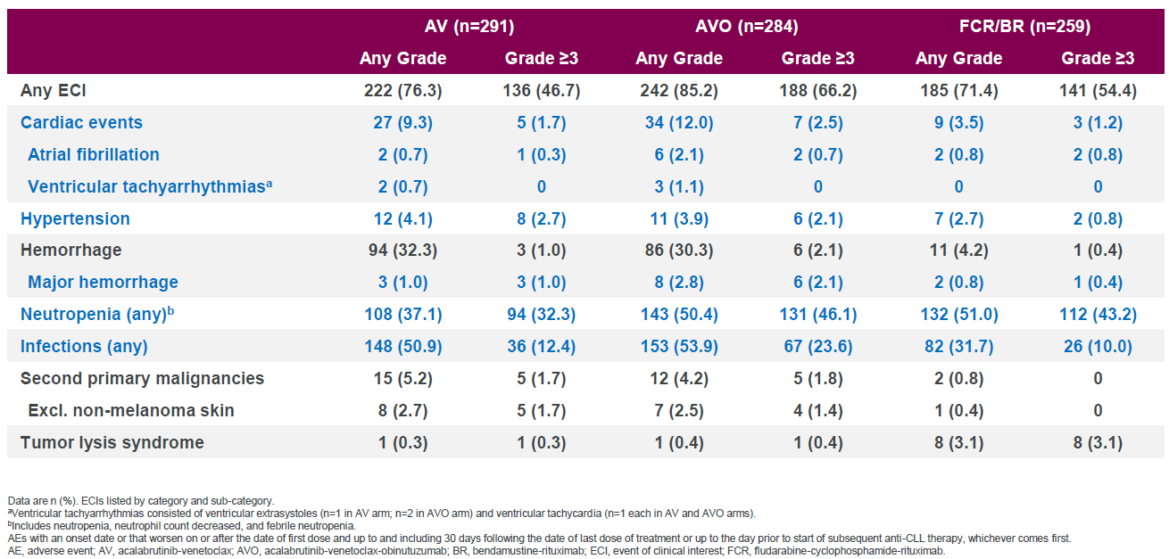
AMPLIFY: AESI
COVID-19 deaths: 10 (AV), 25 (AVO), 21 (FCR/BR)
Brown et al NEJM 2025

Slide 63
FDA Approves Acalabrutinib with Venetoclax for Chronic Lymphocytic Leukemia or Small Lymphocytic Lymphoma Press Release: February 19, 2026
“On February 19, 2026, the Food and Drug Administration approved acalabrutinib tablets and capsules in combination with venetoclax for adults with chronic lymphocytic leukemia (CLL) or small lymphocytic lymphoma (SLL).
Efficacy was evaluated in AMPLIFY (NCT03836261), a randomized, multicenter trial in adult patients previously untreated for CLL without del(17p) or TP53 mutation. Patients were randomized to receive acalabrutinib and venetoclax (AV) or Investigator’s choice of chemotherapy (fludarabine plus cyclophosphamide plus rituximab [FCR] or bendamustine plus rituximab [BR]).
The major efficacy outcome measure was progression-free survival (PFS) as assessed by independent review committee for the AV arm versus the investigator’s choice arm (FCR/BR). The median duration of PFS follow-up was 42.6 months. Median PFS was not estimable (NE) (95% CI: 51.1, NE) in the AV arm and 47.6 months (95% CI: 43.3, NE) in the FCR/BR arm (Hazard ratio 0.65 [95% CI: 0.49, 0.87]; p-value 0.0038). With a median follow-up of 41.0 months, there were 18 (6%) deaths in the AV arm and 42 (14%) in the FCR/BR arm.”
https://www.fda.gov/drugs/resources-information-approved-drugs/fda-approves-acalabrutinib-venetoclax-chronic-lymphocytic-leukemia-or-small-lymphocytic-lymphoma

Slide 64
SEQUOIA Arm D: Phase 3 Trial of Zanu/Ven Combinations as First-line Treatment for CLL/SLL
Arm A: Zanubrutinib
160 mg bid until PD, intolerable toxicity, or end of study
(n = 241)
Open
label
Key Eligibility Criteria
Untreated CLL/SLL
Met iwCLL criteria for treatment
> 65y or > 18y of age and unsuitable for treatment with FCRª
Anticoagulation and CYP3 inhibitors allowed
Cohort 1
without del(17p)
by central FISH
Arm B: Bendamustine
(90 mg/m² D1 and D2) + rituximab (375 mg/m² C1, then 500 mg/m² C2-C6) for 6 cycles
(n = 238)
Patients with centrally confirmed PD could cross over to receive zanubrutinib
Disease Assessments
Response assessments conducted every 3 cycles until C28 and every 6 cycles after C28 until PD
Bone marrow MRD repeated every 12-24 weeks in pts with CR/CRi and two consecutive PB-undetectable MRDs ~12 wks apart, optional after C27 for pts with detectable MRD in BM
TLS at baseline and pre-venetoclax initiation
Endpoints for Arm D
PFS ORR OS uMRD4 rate (<10⁻⁴ sensitivity) Safety
R
Stratification factors: age, Binet stage, IGHV status, geographic region
Cohort 2
with del(17p)
Arm C: Zanubrutinib
160 mg bid until PD, intolerable toxicity, or end of study
(n = 111)^{b}
NCT03336333
Statistical analysis: Efficacy endpoints analyzed using ITT analysis and the per protocol analysis set. Safety was assessed in all patients who received >1 dose of treatment.
Cohorts 1 and 2
Arm D: Zanubrutinib 160 mg bid starting at C1
+ Venetoclax*
QD from C4-C28
(n = 114)
ª Defined as Cumulative Illness Rating Scale >6, creatinine clearance <70 mL/min, or a history of previous severe infection or multiple infections within the last 2 years;
^{b} One patient without del(17p) was misassigned to the nonrandomly assigned cohort of patients with del(17p). The patient is excluded from the efficacy analysis in this cohort;
^{c} Defined as the time from randomization to death or the date of progression on the next line of therapy subsequent to study treatment.
BID, twice daily; BM, bone marrow; C, cycle; CLL/SLL, chronic lymphocytic leukemia/small lymphocytic lymphoma; CR, complete response; CRi, complete response; FCR, fludarabine, cyclophosphamide, rituximab; FISH, fluorescence in situ hybridization; IGHV, immunoglobulin heavy chain variable region; ITT, intention-to-treat; iwCLL, International Workshop on Chronic Lymphocytic Leukemia; MRD, minimal residual disease; ORR, overall response rate; OS, overall survival; PB, peripheral blood; PD, progressive disease; PFS, progression-free survival; QD, once daily; TLS, tumor lysis syndrome; uMRD4, undetectable minimal residual disease at 10⁻⁴ sensitivity.
*This regimen is not yet FDA-approved
1. Tam, et al. Lancet Oncol. 2022;23(8):1031-1043. 2. Shadman, et al. 17th ICML. June 13-17, 2023; Abstract 154. 3. Shadman, et al. ASCO 2025. May 30 – June 3, 2025. Chicago, IL. Abstract 7009.

Slide 65
SEQUOIA Arm D: Schedule
C1
C4
C7
C10
C13
C16
C19
C22
C25
C28+
Continue zanubrutinib until uMRD early stopping criteria
Zanubrutinib 160 mg BID
Venetoclax 400 mg QD
Discontinue venetoclax due to uMRD early stopping criteria
Baseline and end of C3:
TLS risk assessment
Hematology/physical examination/imaging
MRD: PB
BM biopsy and aspirate for CRª
MRD: BM aspirate^{b}
Median follow-up: 38.5 months
uMRD-guided stopping criteria
All conditions must be met:
Response assessed as CR or CRi confirmed by a BM biopsy
uMRD <1x10⁻⁴ (uMRD4) achieved in 2 consecutive peripheral blood MRD tests conducted ≥12 weeks apart
uMRD4 achieved in 2 consecutive BM aspirate MRD tests conducted ≥12 weeks apart
Received:
i) Minimum of 12 cycles of venetoclax (to stop venetoclax early)
ii) Minimum of 27 cycles of zanubrutinib (to stop zanubrutinib early)
aBM biopsy and aspirate are required to confirm a suspected CR/Cri (BM biopsy collection timepoint not defined per protocol), starting after cycle 9 and then annually if needed. bPatients with confirmed CR/CRi and 2 consecutive PB-uMRD results at least 12 weeks apart.
Shadman, et al. ASCO 2025. May 30 – June 3, 2025. Chicago, IL. Abstract 7009.
BID, twice daily; BM, bone marrow; C, cycle; CR, complete response; CRi, complete response with incomplete hematologic recovery; MRD, minimal residual disease; PB, peripheral blood; QD, once daily; TLS, tumor lysis syndrome; uMRD, undetectable minimal residual disease; uMRD4, undetectable MRD at 10⁻⁴ sensitivity
*This regimen is not yet FDA-approved

Slide 66
SEQUOIA Arm D: Response and MRD Rates
Peripheral Blood uMRD Rates by Genomic Risk and Treatment Duration
Response Rates
ORR 98.5%
Outcome | Overall | del(17p) and/or TP53mut | No del(17p)/TP53mut | Unmutated IGHV | Mutated IGHV
Best peripheral blood uMRD rate | 60% | 59% | 62% | - | -
uMRD after 15 cycles | - | 15% | 40% | 23% | 33%
uMRD after 27 cycles | - | 38% | 36% | 40% | 29%
ORR 95.7%
ORR 97.4%
100
90
CR
80
CRi
70
45.5
48.9
47.4
60
0.9
nPR
50
1.5
PR
Patients (%)
2.1
0.9
40
PR-L
30
50.0
44.7
47.4
20
10
1.5
0.9
0
Treatment Discontinuation and Durability
With del(17p) and/or TP53mut (n = 66)
38.7
(0.4-58.0)
Without del(17p) and/or TP53mut (n = 47)
29.6
(0.6-31.9)
All patients (n = 114)
31.2
(0.4-58.0)
Median study follow-up, Months (range)
Measure | Value
Patients meeting early stopping criteria | 13/114
Patients meeting criteria to stop ZV | 42/114
Patients maintaining uMRD after discontinuation (18-month follow-up) | 92-100%
CR, complete response; CRi, complete response with incomplete hematopoietic recovery; EOS, end of study; IGHV, immunoglobulin heavy-chain variable region gene; MRD, minimal residual disease; mut, mutation; nPR, nodular partial response; ORR, overall response rate; PB-uMRD, peripheral blood-undetectable minimal residual disease; PD, progressive disease; PR, partial response; PR-L, partial response with lymphocytosis; uMRD, undetectable minimal residual disease; TP53, tumor protein p53; ZV, zanubrutinib + venetoclax.
Shadman, et al. ASCO 2025. May 30 – June 3, 2025. Chicago, IL. Abstract 7009. Response rates Note the uMRD rates are from ASH 2025 Shadman et al
*This regimen is not yet FDA-approved

Slide 67
SEQUOIA Arm D: PFS
Overall Population and Patients with and without del(17p) and/or TP53mut
Unmutated and Mutated IGHV
36 mo. PFS
36 mo. PFS
100
87%
(95% CI, 78.6-92.4)
100
87%
(95% CI, 76.6-92.8)
80
w/o del(17p) and/or TP53mut
87%
(95% CI, 75.6-93.3)
All patients
80
88%
(95% CI, 66.1-95.8)
IGHV unmutated
60
w/ del(17p) and/or TP53mut
60
IGHV mutated
89%
(95% CI, 75.8-95.3)
PFS Probability
PFS Probability
40
40
20
20
0
0
0
3
6
9
12
15
18
21
24
27
30
33
36
39
42
45
48
51
54
57
60
63
66
0
3
6
9
12
15
18
21
24
27
30
33
36
39
42
45
48
51
54
57
60
63
66
Months
Months
Median study follow-up
With del(17p) and/or TP53mut: 46.1months
Without del(17p) and TP53mut: 36.9 months
Zanu + ven demonstrated durable PFS, with comparable outcomes in patients harboring del(17p)/TP53 mutations.
CI, confidence interval; IGHV, immunoglobulin heavy-chain variable region gene; ITT, intention-to-treat; mut, mutation; PFS, progression-free survival; TP53, tumor protein p53; ven, venetoclax; w/o, without; zanu, zanubrutinib.
Shadman, et al. ASCO 2025. May 30 – June 3, 2025. Chicago, IL. Abstract 7009.
*This regimen is not yet FDA-approved

Slide 68
SEQUOIA Arm D: Safety
TEAEs in >15% of Patients
TEAEs of Special Interest
Any TEAE | All Patients (N=114)
 | Any Grade, n (%) | Grade ≥3, n (%)ª
COVID-19 | 63 (55) | 2 (2)
Diarrhea | 49 (43) | 7 (6)
Contusion | 37 (33) | 0
Nausea | 36 (32) | 0
Neutropenia/neutrophil count decreased | 30 (26) | 27 (24)
Fatigue | 28 (25) | 0
Arthralgia | 24 (21) | 0
Upper respiratory tract infection | 22 (19) | 1 (1)
Cough | 21 (18) | 0
Hypertension | 18 (16) | 10 (9)
 | All Patients (N=114)
 | Any Grade, n (%) | Grade ≥3, n (%)
Any TEAE of special interest | 111 (97) | 50 (44)
Infections | 96 (84) | 14 (12)^{b}
Grade 3 | - | 13 (11)
Hemorrhage | 61 (54) | 2 (3)
Neutropenia | 31 (27) | 27 (24)
Second primary malignancies | 22 (19) | 6 (5)
Skin cancers | 15 (13) | 0
Hypertension | 18 (16) | 10 (9)
Thrombocytopenia | 13 (11) | 5 (4)
Anemia | 10 (9) | 1 (1)
Major hemorrhage | 4 (4) | 3 (3)
Atrial fibrillation and flutter | 3 (3) | 2 (2)
Opportunistic infections | 3 (3) | 0
Tumor lysis syndrome | 1 (1) | 0
Zanubrutinib + venetoclax had a favorable safety profile. Five deaths occurred in this study due to AEs (none were treatment related); no new events were reported at this follow-up at 38.5 months.
ªTEAEs in ≥5% of patients are reported. ^{b}Grade 5 infection occurred in one patient (pneumonia staphylococcal and septic shock).
AE, adverse event; TEAE, treatment-emergent adverse event.
Shadman, et al. ASCO 2025. May 30 – June 3, 2025. Chicago, IL. Abstract 7009.
*This regimen is not yet FDA-approved

Slide 69
High Level Summary of Reported Sonrotoclax Studies in 1L
Trial | Drugs | Treatment Duration | Longest Follow-up | ORR/CR | MRD4/MRD6 EOT or EOT+3 | PFS (uIGHV/mIGHV) | OS | Infections Gr3 or Greater
BGB-11417-101 | SO | 15 cycles | 12m | 94%/40% | 83%/75% | NR | NR | 9% (COVID)
BGB-11417-101 | ZS | TTP | 19.3m | 100%/42% | 91%/NR | 100% | NR | 1% COVID No Gr3 or greater URTI
CELESTIAL: ZS vs VenO in 1L CLL is Enrolled and awaiting endpoint data maturity

Slide 70
Session Summary
CLL17 currently at 3 years of follow-up (1.5 years after cessation) no differences between groups or approaches in PFS or OS.
We are starting to see some separation in curves in high risk CLL favoring continuous therapy in terms of PFS.
mIGHV has highest PFS rate at 3 years with VenO
A+V is now approved in the US as a second FD option
uIGHV suggests a benefit from Triplet Approaches in terms of PFS over AV
mIGHV may still benefit from attaining MRD or using antiCD20 but may not require Triplet therapy to achieve the optimal outcome
Current evidence at short follow-up shows no differences in outcome based on MRD status with oral doublets thus it remains unclear how important this endpoint is for mIGHV
Zanubrutinib/BCL2 combinations either as FD or MRD Guided Approaches are safe effective and entered into guidelines
Sonrotoclax is now approved in MCL on accelerated basis and demonstrates unique characteristics and MRD kinetics as compared to venetoclax
Currently any approach is appropriate, but FD approaches are increasingly considered, still important to review preferences, comorbidities, and philosophy when choosing a therapy

Slide 71
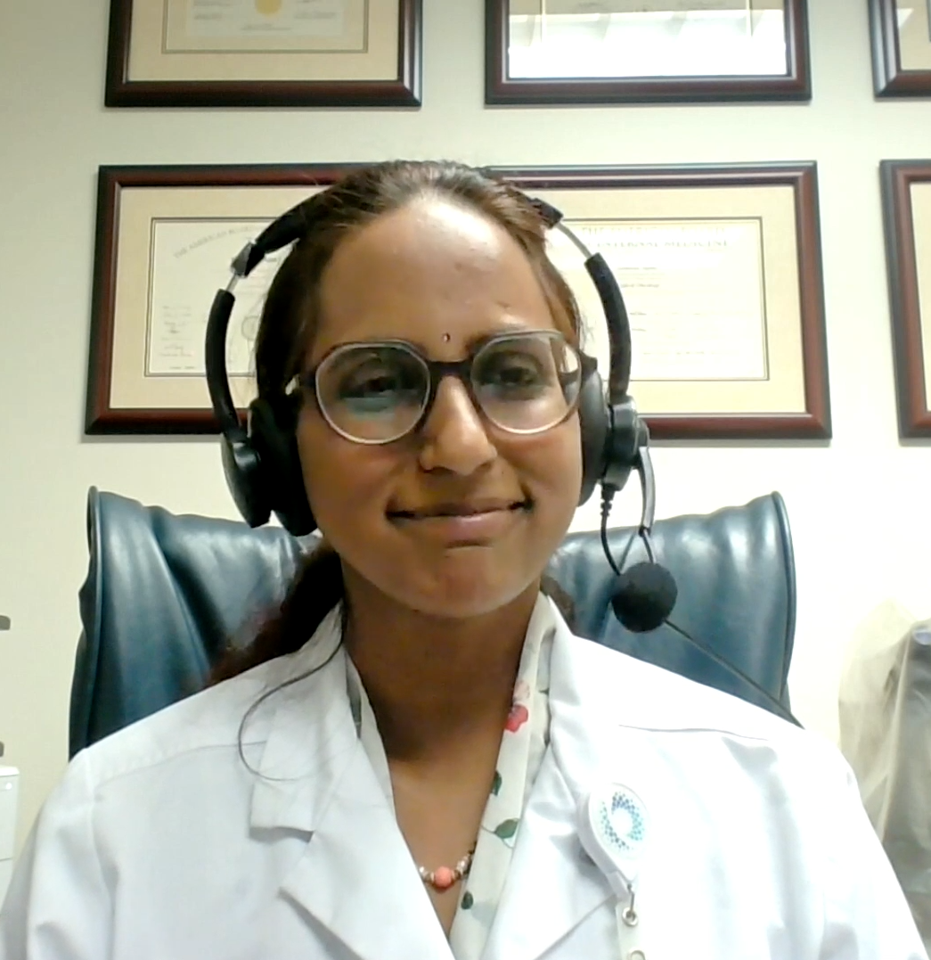
Cases from the Community
Susmitha Apuri, MD
Neil Love, MD

Slide 72
Discussion Questions
How would you approach tumor lysis syndrome (TLS) mitigation and monitoring for this patient?
How, if at all, does your approach to TLS mitigation and monitoring differ for patients receiving venetoclax in combination with acalabrutinib versus those receiving venetoclax in combination with obinutuzumab?
How do you approach hydration, and in which scenarios, if any, do you employ rasburicase?
How, if at all, does your algorithm for monitoring for and managing adverse events beyond TLS differ for patients receiving combination therapy with a BTK inhibitor and venetoclax versus those receiving either agent alone?
Once you’ve made the decision to administer up-front acalabrutinib/venetoclax, for which patients, if any, do you also incorporate an anti-CD20 antibody?

Slide 73
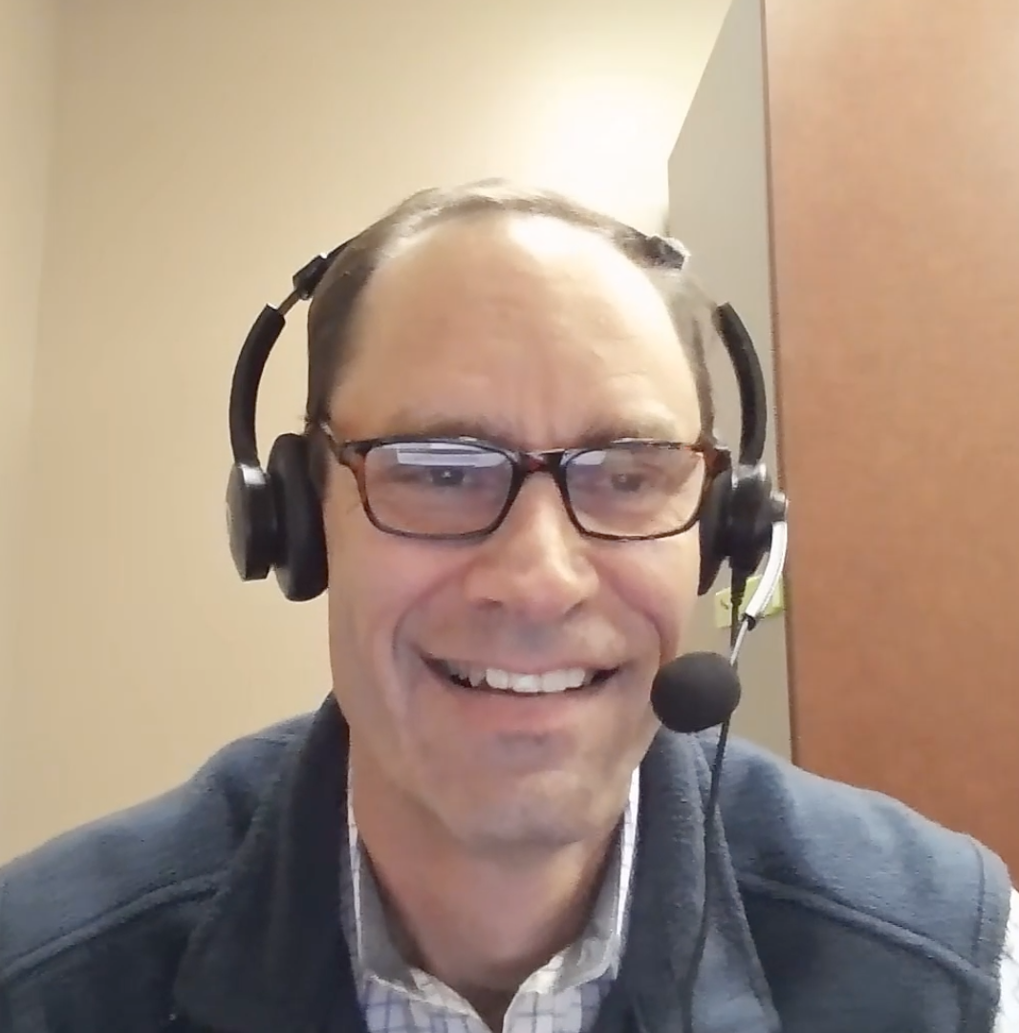
Cases from the Community
Stephen “Fred” Divers, MD
Susmitha Apuri, MD
Neil Love, MD

Slide 74
Discussion Questions
Particularly for patients who are older and/or have significant comorbidities, how do you choose between single-agent continuous BTK inhibitor therapy and a time-limited combination strategy? For patients who prefer time-limited therapy, how do you decide between venetoclax/obinutuzumab and venetoclax/acalabrutinib?
What initial treatment would you most likely recommend for Dr Apuri’s patient with significant ischemic cardiomyopathy?
Which pretreatment cardiac comorbidities or cardiac incidents do you believe represent an absolute contraindication to the use of BTK inhibitor therapy? Does this differ at all for acalabrutinib versus zanubrutinib? What about for the covalent BTK inhibitors versus pirtobrutinib?

Slide 75
Agenda
Module 1: Current and Future Role of Continuous Bruton Tyrosine Kinase (BTK) Inhibitor Therapy for Previously Untreated Chronic Lymphocytic Leukemia (CLL) — Dr Fakhri
Module 2: Available and Emerging Approaches to Time-Limited Therapy for Treatment-Naïve CLL — Dr Allan
Module 3: Optimal Management of Adverse Events (AEs) with BTK and Bcl-2 Inhibitors; Considerations for Special Patient Populations — Dr Ma
Module 4: Selection and Sequencing of Therapy for R/R CLL — Dr Shadman
Module 5: Chimeric Antigen Receptor (CAR) T-Cell Therapy and Other Novel Strategies for CLL — Dr Abramson

Slide 76
Optimal Management of Adverse Events with BTK and Bcl-2 Inhibitors; Considerations for Special Populations
Shuo Ma, MD, PhD
Professor of Medicine
Division of Hematology-Oncology
Department of Medicine
Robert H Lurie Comprehensive Cancer Center
Northwestern University
Chicago, Illinois

Slide 77
Considerations of BTKi vs Bcl-2i
 | BTKi | BCL2i
Advantages | Effective in all prognostic groups Easy to initiate Low Risk of TLS | Limited duration therapy Low toxicity once ramped up
Disadvantages | Continuous therapy Cardiovascular side-effects Bleeding side-effects | IgHV and TP53 aberrant ↓PFS TLS risk
Drug interactions
CYP3A Inhibitors (eg strong azoles): dose reduce zanubrutinib, ibrutinib, venetoclax; hold acalabrutinib.
PPI: no longer an issue with tablet formulation of acalabrutinib.
Avoid concomitant dual anti-platelet inhibition with any BTKi.
Apixaban is the preferred anticoagulant in patients on BTKi.
BCL2i = B-cell lymphoma 2 inhibitor; BTKi = Bruton tyrosine kinase inhibitor; TLS = tumor lysis syndrome
Adapted from Tam C. Hematology Am Soc Hematol Educ Program. 2021:55-58.
Content courtesy of Professor Constantine Tam, MBBS, MD

Slide 78
Key Differences Between BTKis
 | Ibrutinib | Acalabrutinib | Zanubrutinib | Pirtobrutinib
BTK binding | Covalent, C481 | Covalent, C481 | Covalent, C481 | Reversible, ATP pocket, Distant from C481
Half-life | 6 hours | 1 hour | 4 hours | 20 hours >90% BTK inhibition
BTK Y223 autophosphorylation | Inhibited |  |  | Inhibited
BTK Y551 phosphorylation | No effect |  |  | Inhibited (maintenance of closed conformation)
Mechanisms of resistance | BTK C481S: Common | BTK C481S: Reported | BTK C481S: Reported | Effective against C481S
ATP, adenosine triphosphate; HCK, hematopoietic cell kinase. *With the exception of RT, in which T474I, T474S, and L528W have been reported at progression on ibrutinib.20 †For ibrutinib, acalabrutinib, and zanubrutinib, derived from review by Estupinan et al, ´ 12 >80% inhibition at clinical doses; for pirtobrutinib, listed kinases have
Thompson, PA, et al. Blood 2023; 141(26):3137-3142.

Slide 79
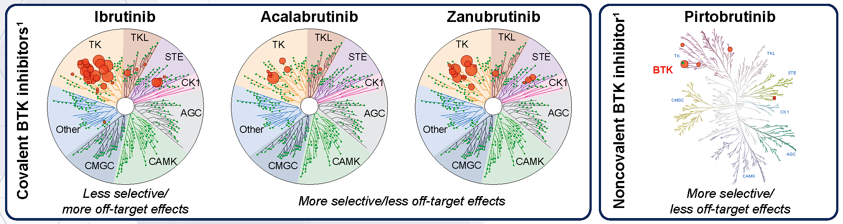
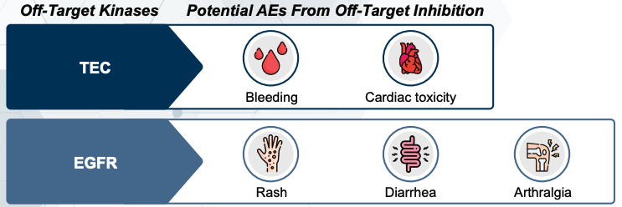
More selective BTKi have fewer off-target effects, leading to significantly improved safety profiles
Potential off-target effects include:
Content courtesy of Matthew S Davids, MD, MMSc

Slide 80
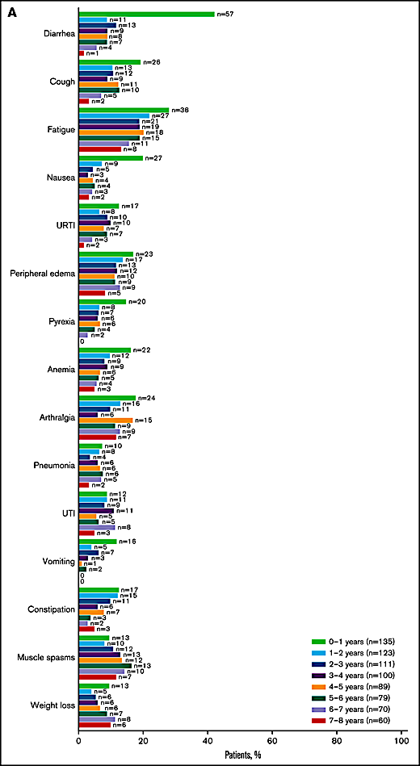
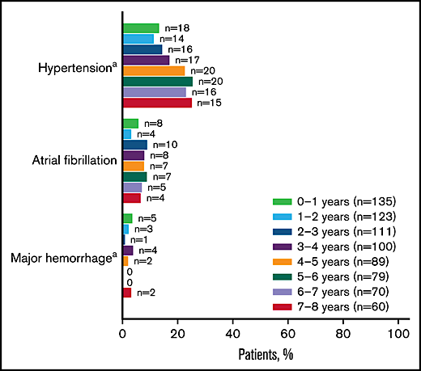

Discontinuation rates with ibrutinib are relatively high, and are due mostly to AEs
Discontinuation due to AEs may be even more common in the real-world setting (41% discontinuation at median of 17 mo.)
42% of patients still on ibrutinib at 8 years
Most common reason for discontinuation was AEs (24%)
Mato AR et al., Haematologica 2018;103:874-9.
Barr PM et al. Blood Adv 2022;6:3440-50.
Content courtesy of Matthew S Davids, MD, MMSc

Slide 81
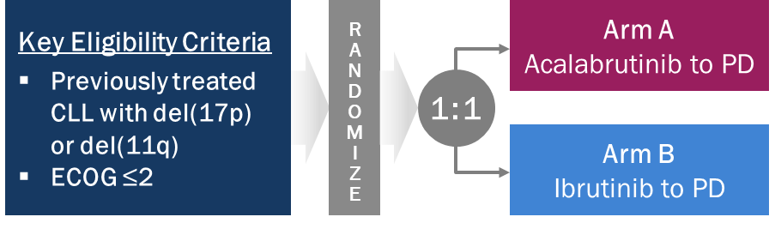
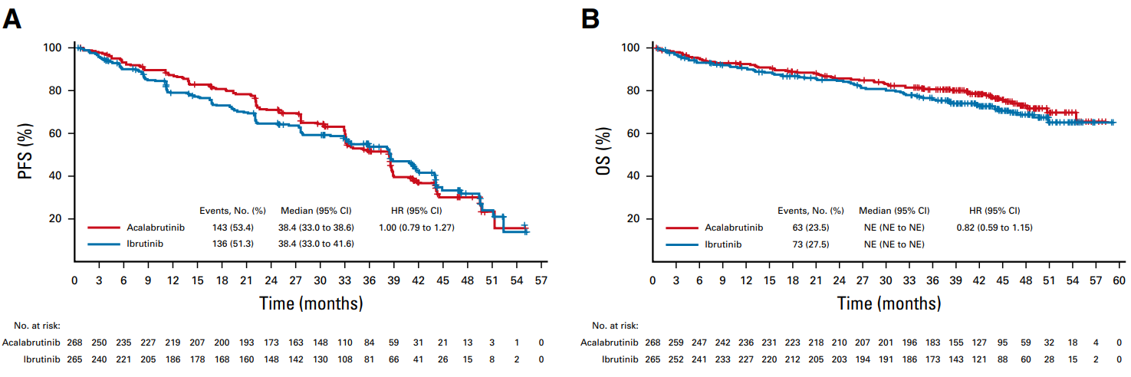
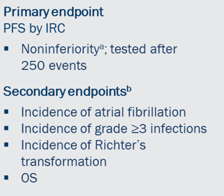
ELEVATE-RR: Acalabrutinib vs. Ibrutinib in R/R CLL
Study Design¹
IRC-assessed PFS (median f/u: 40.9 mo)²
Median PFS: 38.4 months (both arms)
Prespecified subgroup analysis of IRC-assessed PFS²
OS (median f/u: 40.9 mo)²
Subgroup | Category | Acalabrutinib (Events/Patients) | Ibrutinib (Events/Patients) | HR (95% CI)
Presence of del(17)(p13.1) | Yes | 76/124 | 72/121 | 1.00 (0.73 to 1.38)
 | No | 67/144 | 64/144 | 1.00 (0.71 to 1.41)
TP53 mutation | Yes | 64/100 | 73/112 | 0.95 (0.68 to 1.33)
 | No | 79/167 | 63/153 | 1.11 (0.80 to 1.55)
IGHV | Mutated | 13/44 | 13/28 | 0.60 (0.28 to 1.31)
 | Unmutated | 130/220 | 123/237 | 1.09 (0.85 to 1.40)
Complex karyotype | Yes | 74/124 | 66/125 | 1.04 (0.74 to 1.44)
 | No | 52/116 | 56/116 | 0.92 (0.63 to 1.35)
Median OS: NR in any treatment arm
1. Hillmen P, et al. EHA 2021. Abstract S145. 2. Byrd JC, et al. J Clin Oncol. 2021;39(31):3441-3452.

Slide 82
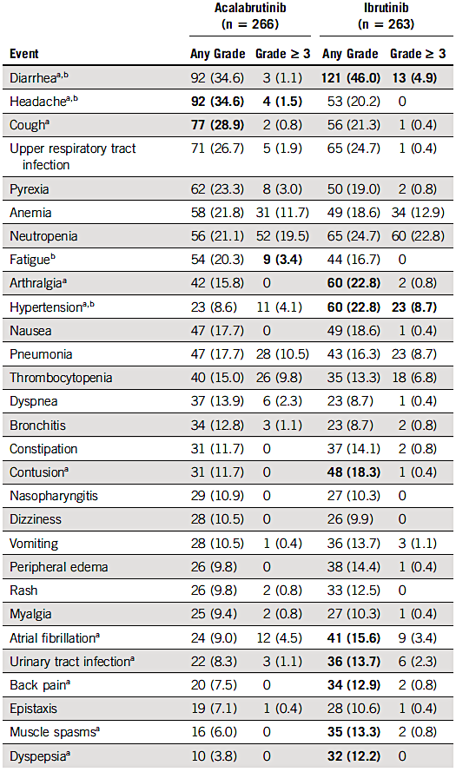
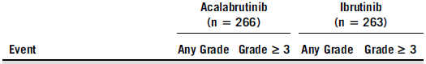
ELEVATE-RR: Acalabrutinib vs. Ibrutinib in R/R CLL - Safety
1. Hillmen P, et al. EHA 2021. Abstract S145. 2. Byrd JC, et al. J Clin Oncol. 2021;39(31):3441-3452.
Notes:
Ma new slide

Slide 83
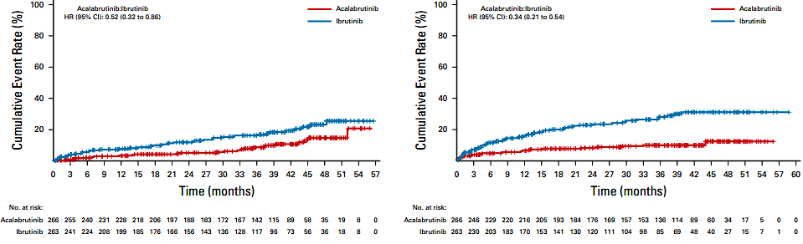
ELEVATE-RR: Atrial Fibrillation and Hypertension
Cumulative Incidence of Atrial Fibrillation
Cumulative Incidence of Hypertension
1. Hillmen P, et al. EHA 2021. Abstract S145. 2. Byrd JC, et al. J Clin Oncol. 2021;39(31):3441-3452.

Slide 84






ALPINE: Zanubrutinib vs. Ibrutinib in R/R CLL
Study Design¹
PFS – Overall (median f/u: 42.5 mo)²
ASH 2025³: 60 mo F/U
Zanu PFS: 52.5 months
PFS – del(17p)/TP53 Mutated (median f/u: 42.5 mo)²
OS – Overall (median f/u: 42.5 mo)²
ASH 2025³: 60 mo F/U
Zanu PFS: 49.9 months
Median OS:
NR in any treatment arm
1. Brown JR, et al. N Engl J Med. 2023;388(4):319-332. 2. Brown JR, et al. Blood. 2024;144(26):2706-2717. 3. Tam C, et al. ASH 2025; abs25-10399.

Slide 85

ALPINE: Zanubrutinib vs. Ibrutinib in R/R CLL - Safety
All-Grade Treatment-Emergent Adverse Events Occurring in ≥15% of Patients
References: Brown J, et al. Blood. 2024;144(26):2706-2717.

Slide 86


ALPINE: Atrial Fibrillation/Flutter and HTN
After 42.5 months of median follow-up, incidence of Afib/flutter was lower with zanubrutinib vs ibrutinib (7.1% vs 17.0%)
Time to Occurrence - Afib/Flutter
After 42.5 months of median follow-up, incidence of hypertension was higher with zanubrutinib vs ibrutinib (27.2% vs 25.3%)
Time to Occurrence - Hypertension
References: Brown J, et al. Blood. 2024;144(26):2706-2717.

Slide 87

BRUIN CLL-314: Pirtobrutinib vs. Ibrutinib
Woyach et al. ASH 2025

Slide 88

BRUIN CLL-314: Pirtobrutinib vs. Ibrutinib in TN or R/R CLL
Woyach et al. ASH 2025

Slide 89

Platelet Inhibition by Ibrutinib
2A: STABLE IBRUTINIB THERAPY
2B: CEASED IBRUTINIB FOR 1 WEEK
2C: RESTARTED IBRUTINIB FOR 1 WEEK
Kamel et al. Leukemia 2015;29(4): 83-7; Levade et al. Blood 2014;124(26):3391-5.
Content courtesy of Professor Constantine Tam, MBBS, MD

Slide 90
Bleeding Risk with BTKi Treatment
Bleeding risk is due to inhibition of platelet function via both on-target and off-target effects of BTKi.
Hold BTKi treatment for 3-7 days before and after an invasive procedure with bleeding risk.
Bleeding risk is increased when BTKi is combined with other antiplatelet agents or anticoagulants. Monitor closely.
Avoid concurrent use of BTKi with dual antiplatelet agents or warfarin because of increased bleeding risk.
In case of intolerance to a covalent BTKi, consider switching to an alternative covalent BTKi or noncovalent BTKi.

Slide 91
Incidence and Management Recommendations for Select BTKi -Associated Cardiologic Adverse Events and Bleeding
Adverse event | BTK inhibitor | Incidence Any grade, Grade ≥3 % | Management
Atrial fibrillation | Ibrutinib | 16, 2-5 | Avoid stroke; anticoagulation Better symptom control: rate vs rhythm Cardiovascular and other comorbidity management
 | Acalabrutinib | 6-9, 1-5
 | Zanubrutinib | 3-6, ≤1
 | Pirtobrutinib | 2.8, 1.2
Hypertension | Ibrutinib | 16-23, 8-12 | Correct predisposing factors Antihypertensive therapy
 | Acalabrutinib | 7-9, 3-4
 | Zanubrutinib | 14-17, 6-15
 | Pirtobrutinib | 9.2, 2.3
Bleeding | Ibrutinib | 36-51, 3-4 | Minor bleeding: no intervention Major bleeding: Consider treatment discontinuation Platelet transfusions regardless of platelet counts
 | Acalabrutinib | 36-51, 3
 | Zanubrutinib | 36-45, 3
 | Pirtobrutinib | —
Galitzia A et al. Cancers 2024;16:1996; Jurczak W et al. EHA 2023;Abstract P618.

Slide 92


Slide 93

Ganatra S et al. J Am Coll Cardiol 2026;87(5):654-82.

Slide 94
Cardiovascular Management with BTKi
 | Assessments | Action
Before BTKi | Personal and family history Clinical examination Blood pressure Baseline ECG Echo if history of CV disease or poorly controlled HTN | Avoid BTKi if Personal or family history of ventricular arrhythmias Uncontrolled HTN LVEF abnormal (definitely if <30%)
Hypertension | BP weekly x 3 months Then monthly | Treat >135/85 mmHg ACE-I/ARB > others as needed
Atrial fibrillation | Clinical examination Consider ECG q3 monthly | ECG if suspicion of AF Echo and beta blockers Apixaban if CHADS-VASC2 > 2
Adapted from Awan FT et al. Blood Adv 2022;6:5516-25; Munir T et al. Acta Haematol 2025;1-16.
Content courtesy of Professor Constantine Tam, MBBS, MD

Slide 95

New-Onset A-fib
JACC 2026

Slide 96
Incidence and Management Recommendations for Select BTK Inhibitor-Associated Noncardiovascular Adverse Events
Adverse event | BTK inhibitor | Incidence Any grade, Grade ≥3 % | Management
Neutropenia | Ibrutinib | 25-39, 13-31 | Growth factor support
 | Acalabrutinib | 21-23, 13-19
 | Zanubrutinib | 37-34, 15-19
 | Pirtobrutinib | 25, 20.3
Diarrhea | Ibrutinib | 22-59, <1-4 | Symptomatic treatments and dose adjustments Dietary modifications, hydration, anti-diarrheal medications Probiotics
 | Acalabrutinib | 18-39, 1-5
 | Zanubrutinib | 14-18, <1-2
 | Pirtobrutinib | 24.2, 0-9
Headache | Ibrutinib | 14-18, 1-2 | Moderate dose of caffeine or acetaminophen
 | Acalabrutinib | 22-39, <1
 | Zanubrutinib | 11-12, 0-1
 | Pirtobrutinib | 13.1, 0.5
Galitzia A et al. Cancers 2024;16:1996; Jurczak W et al. EHA 2023;Abstract P618.

Slide 97
Other BTKi/Bcl-2i Side Effects
 | Comment | Solution
Nuisance side effects (myalgias, arthralgias, rash, cough, edema) | Mainly seen in ibrutinib | Dose reduce or use second-generation BTKi
Neutropenia | More common with venetoclax and zanubrutinib | Monitor or twice-weekly GCSF x 4 weeks. Usually don’t need to dose reduce
Nausea/dyspepsia/diarrhea | Mainly seen in ibrutinib and venetoclax | Dose reduce (ibrutinib) or try night-time dosing (venetoclax)
Headache | Mainly seen in acalabrutinib | Caffeine and patience (usually resolves)
Brown JR et al. N Engl J Med 2025;392(8):748-62; Kater AP et al. NEJM Evid 2022;1. Shadman M et al. J Clin Oncol. 2025;43:2409-17; Tam C. Hematology Am Soc Hematol Educ Program 2021:55-8; Timofeeva N et al. Blood Neoplasia 2024;1:100034.

Slide 98

Adverse Events (AEs) with Bcl-2i-Based Therapy
MURANO AEs¹
MURANO - Serious AEs¹
VenR (N=194)
BR (N=188)
VenR (N=194)
BR (N=188)
5%
ReVenG AEs² (>10% of patients, N=25)
ReVenG AEs² (>5% Grade ≥ 3 TEAEs, N=25)
1. Seymour JF et al. N Engl J Med 2018;378(12):1107-20. 2. Davids M et al. EHA 2025;Abstract PF575.

Slide 99
Venetoclax Induces Rapid Reduction in CLL
Single dose of 200mg (n=2) or 100mg (n=1)
Rapid reduction in CLL within 24hrs
Evidence of TLS in all 3 patients, one with transient disseminated intravascular coagulation
Souers AJ et al. Nat Med 2013;19:202-8; Roberts et al. 2012 EHA Congress.
Lymphocyte Counts (Red; n = 2) and LDH (Blue; n = 3) post first dose
Content courtesy of Professor Constantine Tam, MBBS, MD

Slide 100


Monitoring TLS with Venetoclax
20mg,
50mg
100mg,
200mg,
400mg
No need to monitor post-dose in low and medium risk.
Adapted from Cheson BD et al. Oncologist 2017;22:1283-91; Venetoclax PI
Content courtesy of Professor Constantine Tam, MBBS, MD

Slide 101

Monitoring Venetoclax TLS: A Case Example
Anderson MA et al. Cancers (Basel) 2024;16(5):980.

Slide 102
BTKi + Bcl-2 Combinations
Ibrutinib + Venetoclax¹
Main issue is diarrhea / GI side-effects -> try splitting the drugs.
May increase risk of CV deaths in select populations (older, WM).
Use with extreme caution in elderly, comorbid, CV disease.
Acalabrutinib + Venetoclax / Zanubrutinib + Venetoclax^{2,3}
Much better tolerated in terms of GI toxicity.
CV safety seems similar to 2nd gen BTKi monotherapy.
Triple BTKi/BCL2i/CD20 Combinations⁴
Increased severe infections (esp COVID-19) > neutropenia.
1. Kater AP et al. NEJM Evid 2022;1. 2. Brown JR et al. N Engl J Med 2025;392(8):748-62. 3. Shadman M et al. J Clin Oncol 2025;43:2409-17. 4. Timofeeva N et al. Blood Neoplasia 2024;1:100034.
Content courtesy of Professor Constantine Tam, MBBS, MD

Slide 103

Phase III AMPLIFY Study: Combined Bcl-2i/BTKi with and without Anti-CD20 Monoclonal Antibody
AV
AVO
Brown JR et al. N Engl J Med 2025;392(8):748-62.

Slide 104
Cases from the Community
Susmitha Apuri, MD
Neil Love, MD

Slide 105
Discussion Questions
What would you recommend for this patient with worsening fatigue/cytopenias and recurrent infections during the venetoclax ramp-up? How do you determine whether to recommend IVIG or G-CSF for these patients?
Do you recommend prophylactic antimicrobials for your patients with CLL who are going to begin treatment with venetoclax? Does this depend at all on what it will be partnered with?
For patients with CLL who are receiving fixed-duration venetoclax/obinutuzumab as initial therapy, do you generally assess for minimal residual disease (MRD) at the end of treatment? What about those receiving fixed-duration venetoclax/acalabrutinib? Are you any more likely to assess MRD status in the presence of high-risk features?
If a patient has detectable MRD after completing the recommended treatment duration with venetoclax/obinutuzumab, do you continue therapy? What about venetoclax/acalabrutinib?
How often would you check for MRD going forward in this patient’s case?

Slide 106
Agenda
Module 1: Current and Future Role of Continuous Bruton Tyrosine Kinase (BTK) Inhibitor Therapy for Previously Untreated Chronic Lymphocytic Leukemia (CLL) — Dr Fakhri
Module 2: Available and Emerging Approaches to Time-Limited Therapy for Treatment-Naïve CLL — Dr Allan
Module 3: Optimal Management of Adverse Events (AEs) with BTK and Bcl-2 Inhibitors; Considerations for Special Patient Populations — Dr Ma
Module 4: Selection and Sequencing of Therapy for R/R CLL — Dr Shadman
Module 5: Chimeric Antigen Receptor (CAR) T-Cell Therapy and Other Novel Strategies for CLL — Dr Abramson

Slide 107
Selection and Sequencing of Therapy for R/R CLL
Mazyar Shadman, MD MPH
Professor | Innovators Network Endowed Chair
Deputy Chief Medical Officer
Medical Director, Cellular Immunotherapy
Fred Hutch Cancer Center | University of Washington
Seattle, WA

Slide 108


Slide 109
Treatment Options in R/R CLL
BTK inhibitor monotherapy
Covalent BTK inhibitors
Acalabrutinib
Zanubrutinib
Non-covalent BTK inhibitor
Pirtobrutinib
BCL2i-based therapy
Venetoclax-based
Sonrotoclax-based
BTKi and CAR-T cell therapy
Emerging BTK targeting agents

Slide 110
BTKi monotherapy

Slide 111

Acalabrutinib vs. Ibrutinib : ELEVATE-RR
Key Findings
Median PFS
38.4 mo (both arms)
HR 1.00 (95% CI 0.79–1.27) — non-inferiority confirmed
AEs leading to discontinuation
14.9% vs 21.3%
Acala vs Ibrutinib (p=0.0016)
Afib/flutter (any grade)
9.4% vs 16.0%
Acala vs Ibrutinib (p=0.02) — 1° hierarchical secondary endpoint
High-risk population
del(17p) 45% · TP53 37–42%
Unmutated IGHV 82–89% · All pts had del(17p) or del(11q)
Byrd. J et al, JCO, 2021

Slide 112



Zanubrutinib vs. Ibrutinib in R/R CLL: ALPINE
Key Results (median f/u 39 months)
PFS superiority — overall
HR 0.68
(95% CI 0.53–0.86) P=0.0011 ; Zanu 64.9% vs Ibr 54.8% at 36 mo
PFS — del(17p)/TP53mut subgroup
HR 0.52
(95% CI 0.33–0.83) P=0.0047; Zanu 58.6% vs Ibr 41.3% at 36 mo
AEs → discontinuation
15.4% vs 21.3%
Zanubrutinib vs Ibrutinib
PFS — Overall Population
PFS — del(17p)/TP53mut Subgroup
Brown JR et al. N Engl J Med. 2023 ; Brown JR et al. ASH, 2023

Slide 113

BTKi therapy is effective in patients with CLL resistant to Venetoclax
Victor S. et al. Blood, 2020,

Slide 114
Pirtobrutinib in BTKi exposed setting

Slide 115

Pirtobrutinib in R/R CLL: BRUIN phase 1/2
Pirtobrutinib Progression-free Survival With Prior cBTKi, With or Without Prior BCL2i
N=154
N=128
Final update: median PFS in BCL2i-N 22.3 mos; BCL2i-E 15.9 mos
Woyach JA, et al. ASH 2023. Abstract 325; Wierda WG, et al. ASH 2025. Abstract 2115.

Slide 116


Pirtobrutinb vs. IdelaR/BR in RR CLL: BRUIN CLL-321
Time to Next Treatment (TTNT) · Venetoclax-Naïve: Pirto 29.5 mo vs 12.5 mo (HR 0.36, p=0.0001) · Venetoclax-Treated: Pirto 20.0 mo vs 8.7 mo (HR 0.37, p<0.0001)
Sharman J et al, JCO, 2025

Slide 117

Time to Next Treatment/Death in Venetoclax Naïve and Treated pts
Sharman J et al, JCO, 2025

Slide 118
Pirtobrutinib after first-line cBTKi: LOXO-BTK-18001 and BRUIN CLL-321 Studies
 | N=37
Age, median (range) | 69 (42-78)
Unmutated IGHV | 85% (22/26)
Complex Karyotype (≥ 3 abnl) | 65% (11/17)
Mutated TP53 | 43% (13/30)
Del17p | 48% (15/31)
BTK C481S mutated | 33% (10/30)
PLCG2 mutated | 20 % (6/30)
 | N=37
Prior cBTKi | 100%
Ibrutinib | 76%
Acalabrutinib | 14%
Zanubrutinib | 8%
Reason for BTKi discontinuation
Disease progression | 57%
Toxicity | 35%
Eyre TA, ASH, 2025

Slide 119


Pirtobrutinib after first-line cBTKi
Eyre TA, ASH, 2025

Slide 120

BTK resistance mutations: Important Research Area but Not Quite Ready for Clinical Practice
Tam C et al., Blood,2025

Slide 121
BCL2i-based therapy

Slide 122


Slide 123
Venetoclax-Based Therapy After cBTKi in CLL: Real-World Evidence (CORE Study)
Study Design
Key Takeaways
Efficacy Outcomes
① High real-world ORR
Overall ORR ~80% after cBTKi; consistent across 2L (85%) and 3L (80%) therapy
Population/Subgroup | ORR % | Median PFS (mo) | 18-mo PFS % | Median TTNT-D (mo)
Overall (N=205) | 79.4 | 44.1 | 76.2 | 44.2
1L cBTKi → 2L Ven | 85.1 | 43.2 | 80.8 | NR
2L cBTKi → 3L Ven | 80.4 | 44.3 | 82.1 | 44.2
Intolerance (DI; N=88) | 85.0 | NR | 84.1 | NR
1L cBTKi → 2L Ven | 86.4 | 39.5 | 84.1 | 39.5
2L cBTKi → 3L Ven | 88.5 | NR | 89.0 | NR
Progression (DP; N=76) | 76.5 | 30.1 | 71.0 | 30.4
1L cBTKi → 2L Ven | 90.0 | 31.9 | 62.2 | 31.9
2L cBTKi → 3L Ven | 68.4 | 31.8 | 73.1 | 37.4
Ven+Rituximab (VR; N=64) | 71.4 | 39.5 | 77.0 | 37.4
1L cBTKi → 2L Ven | 78.9 | 43.2 | 88.4 | NR
2L cBTKi → 3L Ven | 73.3 | 36.3 | 85.9 | 37.4
Multicenter RWE
CORE Registry 2018-2023
cBTKi:
Ibrutinib 85% ;
Acalabrutinib 7%
Ven:
monotherapy 60%,
VenR 31%;
VenO 9%
Reason for cBTKi DC
Intolerance 43%;
PD 37%
② Durable PFS regardless of line
Median PFS 43–44 mo in both 2L and 3L settings, even after prior CT/CIT (44 mo)
③ Intolerance > Progression
DI group: median PFS NR · DP group: median PFS ~30 mo; cBTKi progression = more aggressive disease
④ VR effective in cBTKi-exposed
Fixed-duration VR: ORR 71%, 18-mo PFS 77%; largest real-world VR dataset post-cBTKi
⑤ Compares favorably to M14-032
ORR = physician-assessed CR or PR. PFS = venetoclax start → progression/death. TTNT-D = venetoclax start → next treatment/death. NR = not reached. 1L/2L/3L = first/second/third line.
Median PFS 44 mo (real-world) vs 24.7 mo (M14-032 phase 2 trial) in heavily pretreated pts
Ghosh N et al. Am J Hematol. 2025;100:511–515

Slide 124
Venetoclax Retreatment in CLL/SLL
Cohort | n | 1st Ven Regimen | Time Off Ven (mo) | 2nd Ven Regimen | ORR / CR (%) | uMRD PB (%) | Median PFS
Shadman et al⁴⁹ Real-world | 48 | Ven mono 58% Ven-O/R 33% · Ven-BTKi 8% | 21 (9–32) | Ven mono / Ven-O/R Ven-BTKi (mixed) | NR | NR | TTNTD 25.9 mo
Niemann et al⁵⁰ GAIA/CLL13 | 49 | Ven-R · Ven-O · Ven-O-Ibr (all 1L) | ~12–15 | Ven-based 23 · Ven-Acala 24 Ven-O-Acala 2 | NR | NR | 2-yr TFS: 81–100%
Brander et al⁵¹ M13-365 | 9 | Ven-R (continuous; stop at uMRD) | 38 (17–69) | Ven-R | 100 / 33 | 22 | 4.9 yr (PFS2: 9.5 yr)
Kater et al⁵² MURANO | 25 | Ven-R (≥2L 100%) | 28 (14–37) | Ven-R | 72 / 24 | 32 | 23 mo (>2yr: 24; <2yr: 14)
Davids et al⁵³ REVENG | 25 | Ven-O (≥2L 43%) | 53 (19–90) | Ven-O (Co-1: 12 mo; Co-2: 24 mo) | 100 / 20 | 85 | NR (f/u 10 mo)
Mazot et al⁵⁴ CLL2-BAG | 7 | Ven-O MRD-guided (all 1L) | 68 | Ven-O MRD-guided | 100 / NR | 43 | 33 mo
Krestin et al⁵⁵ HOVON/REVEAL | 15/44 | Ven-O 47% · Ven-R 53% (all 1L) | 36 (31–43) | Ven-Acala (24 mo) | 100 / 36 | BM:21 PB:43 | 1 PD at 30 mo
Ghia et al⁴⁸ CAPTIVATE | 6 | Ven-Ibr | NR | Ven-Ibr | 83 / 33 | NR | NR
Thompson et al⁵⁶ Real-world | 46 | Ven mono 37% · Ven-R 48% Ven-O/Ibr mixed | 16 (3–52) | Ven mono/R/O/Ibr (mixed) | 79 / 33 | 42 (PB or BM) | 25 mo
Cramer et al⁵⁷ GCLLSG | 13 | Ven-O-Ibr 23% Ven-O 77% | 29 (15–55) | Ven-O-Acala 69% Ven-O/mono mixed | 100 / NR | 92 | No PD at 19 mo
ORR
uMRD (PB)
Median PFS
Time off Ven
72–100%
32–92%
23–58 mo
≥2 years
across all 10 cohorts
substantial heterogeneity
when reported
key predictor of response
(MURANO: HR 0.28)
BCL2 mutations absent after FD regimens (MURANO, REVENG, CAPTIVATE) · Ven = venetoclax; O = obinutuzumab; R = rituximab; Ibr = ibrutinib; Acala = acalabrutinib; uMRD = undetectable MRD; PB = peripheral blood; BM = bone marrow; TTNTD = time to next treatment or death; TFS = treatment-free survival; FD = fixed-duration; 1L/2L = first/second-line
From Castonguay et al. Blood Advances 2026;10(10):3357

Slide 125


pirtobrutinib
Shadman M & Davids DS, Blood, 2025

Slide 126
Emerging BCL2i-based strategies

Slide 127


Pirtobrutinib + Venetoclax + Rituximab in R/R CLL
PRESS RELEASE
Pirtobrutinib

Slide 128

Venetoclax plus Nemtabrutinib in R/R CLL: BELLWAVE-010
Lavie D. et al, iwCLL, 2025

Slide 129

Sonrotoclax in R/R CLL: CELESTIAL-RRCLL
Al-Sawaf O, ASH, 2025 (TiP)

Slide 130
Emerging BTK targeting agents

Slide 131


Addition of Nemtabrutinib plus Liso-Cel in CLL: NemCAR CLL
NCT07194980

Slide 132
Novel BTK Targeting Agents in Development
 | Mechanism of action | N | N of prior lines | Prior cBTKi | Prior ncBTKi | Prior BCL2i | TP53 aberrant | BTK resistance mutations | ORR | Median F/U (m) | PFS
Rocbrutinib | cBTKi and ncBTKi | 42 | 4 (2-9) | 100% | 21% | 45% | 58% | C481S 65% T474I 31% L528W 5% PLCG2 10% | 62-78% | 30 | Median 28 months
Bexobrutideg (NX-5948) | BTK degrader | 126 | 3 (1-17) | 84% | 27% | 62% | NR | BTK 40% PLCG2 8% | 83% | 16 | Median 22 months
BGB-16673 | BTK degrader | 68 | 4 (2-10) | 94% | 21% | 82% | 67% | BTK 40% PLCG2 15% | 85-94% | 20 | 66% at 18 months
Woyach J et. Al , ASH, 2025 ; Omer Z et al, ASH, 2025; Ahn IE, et al, ASH, 2025

Slide 133
Summary
If a covalent BTK inhibitor (cBTKi) is no longer an option (due to progression or intolerance):
BCL2 inhibitor–based therapy
Venetoclax + anti-CD20 antibody
PVR (Pirtobrutinib + Venetoclax + Rituximab) may become a standard-of-care option pending data and regulatory approval
Pirtobrutinib monotherapy
If a BCL2 inhibitor–based regimen is no longer a feasible fixed-duration option:
cBTKi therapy (zanubrutinib or acalabrutinib)
For patients with double-refractory disease, referral for CAR-T cell therapy is recommended while the disease remains under control.

Slide 134


Slide 135
Cases from the Community
Priya Rudolph, MD, PhD
Neil Love, MD

Slide 136
Discussion Questions
When would you expect to see a drop and/or normalization of leukocytosis and lymphocytosis after initiation of BTK inhibitor therapy? Does this differ at all for covalent BTK inhibitors versus pirtobrutinib?
What would you recommend for this patient whose white blood cell count and absolute lymphocyte count continue to rise despite 10 months of pirtobrutinib therapy?
How might the results from the BRUIN CLL-322 trial affect the way you think through pirtobrutinib use in the R/R setting? For which specific patients would you be most inclined to favor pirtobrutinib/venetoclax/rituximab over other available options?
Would you consider substituting pirtobrutinib for a covalent BTK inhibitor for a patient with BTK inhibitor-naïve disease under any circumstances? If so, which ones?

Slide 137
Agenda
Module 1: Current and Future Role of Continuous Bruton Tyrosine Kinase (BTK) Inhibitor Therapy for Previously Untreated Chronic Lymphocytic Leukemia (CLL) — Dr Fakhri
Module 2: Available and Emerging Approaches to Time-Limited Therapy for Treatment-Naïve CLL — Dr Allan
Module 3: Optimal Management of Adverse Events (AEs) with BTK and Bcl-2 Inhibitors; Considerations for Special Patient Populations — Dr Ma
Module 4: Selection and Sequencing of Therapy for R/R CLL — Dr Shadman
Module 5: Chimeric Antigen Receptor (CAR) T-Cell Therapy and Other Novel Strategies for CLL — Dr Abramson

Slide 138
CAR T-Cell Therapy and Other Novel Strategies for CLL
Jeremy S. Abramson, MD, MMSc
Professor of Medicine, Harvard Medical School
Director, Center for Lymphoma, Mass General Brigham Cancer Institute

Slide 139
Liso-cel for relapsed/ refractory CLL and RT

Slide 140



TRANSCEND-CLL: lisocabtagene maraleucel in R/R CLL
Characteristic | N = 118
Median age (range), years | 65 (49-82)
TP53 mutation Del(17p) | 47% 42%
Median prior lines of therapy | 5 (2–14)
Prior cBTKi | 100%
cBTKi refractory | 88%
Prior cBTKi and venetoclax | 81%
cBTKi and venetoclax refractory | 60%
Safety
PFS by Response PFS by uMRD
Response at DL2 | N = 88
ORR CRR | 48% 20%
uMRD4, blood UMRD4, marrow | 66% 60%
Median PFS | 18 mo
Progression-free survival
*subgroup of prior BTKi and venetoclax
median follow-up of 24 months
Sidiqqi, et al. Proc ASH 2024

Slide 141


TRANSCEND-CLL: liso-cel plus ibrutinib Ibrutinib started/continued at enrollment and continued to at least 90 days post liso-cel
PFS by Response
CRS | n = 56
Any grade CRS, n (%) Grade 1 Grade 2 Grade 3 Grade 4 Grade 5 | 45 (80) 20 (36) 23 (41) 2 (4) 0 0
Neurologic events | n = 56
Any grade neurologic event Grade 1 Grade 2 Grade 3 Grade 4 Grade 5 | 23 (41) 8 (14) 9 (16) 5 (9) 1 (2) 0
Wierda, et al. Proc ASH 2024

Slide 142


Liso-cel in Richter’s Transformation: CIBMTR
Characteristic | N = 30
Median age (range), years | 66 (44-82)
TP53 mutation Del(17p) | 40% 46%
Refractory to prior line | 40%
Prior chemoimmunotherapy | 97%
Prior CLL therapy | 77%
Progression-free survival
Median NR
12-mo PFS 54%
76%
ORR: 76%
CRR: 66%
Median DOR: NR
12-mo DOR: 77%
Winter, et al. Proc ASCO 2024

Slide 143
Bispecific Abs for relapsed/ refractory CLL and RT

Slide 144

Epcoritamab, an anti-CD20/CD3 bispecific antibody in relapsed/refractory CLL
Characteristic | All patients N = 23
Median age, years (range) | 72 (55-83)
TP53 aberrations, n (%) | 15 (65)
Median prior lines of tx, n (range) | 4 (2–10)
Best response | N = 23
Best response, n (%)
ORR | 14 (61)
CR | 9 (39)
Median PFS 13 months
Danilov, et al. Proc ASH 2024.

Slide 145

Epcoritamab in Richter’s transformation
Characteristic | N = 42
Median age, years | 69
Elevated LDH | 76%
TP53 aberration | 48%
Prior chemoimmunotherapy | 95%
Prior CLL therapy | 76%
Progression-free survival
Median 3 mos
1st line RT therapy, n=21
All, n=42
2nd line+ RT therapy, n=21
Best response | N = 42
ORR | 48%
CRR | 40%
Median DOR | 10 m
Kader, et al. Lancet Haem 2026

Slide 146


Surovatamig: A CD19 x CD3 bispecific antibody

Slide 147
Novel agents targeting BCL2 and BTK

Slide 148
Sonrotoclax, a next-generation BCL2 inhibitor
 | Sonrotoclax | Venetoclax | Clinical implication for sonrotoclax
Potency (IC₅₀) | 0.014 nM¹ | 0.20 nM¹ | 14-fold more potent, which may lead to deeper target inhibition
Selectivity (vs BCL-xL) | 2000×¹ | 325×¹ | Improved (6-fold) selectivity may improve tolerability
Half-life in humans | ≈5 hours² | 26 hours³ | No accumulation may improve tolerability Short half-life results in simplified TLS monitoring
1. Liu J, et al. Blood. 2024;143(18):1825-1836; 2. Cheah CY, et al. ASH 2022. Abstract 962; 3. Venclexta (venetoclax). Prescribing information. AbbVie Inc; 2022.

Slide 149












Sonrotoclax combinations in CLL: early data
Sonrotoclax + Obinutuzumab
Sonrotoclax + Zanubrutinib
Sonrotoclax-Zanu-Obin
CRR
CRR
uMRD6
uMRD4
uMRD6
CRR
Hoffmann, et al Proc ASH 2025
Tam, et al Proc ASH 2025
Soumerai, et al Proc ASH 2025

Slide 150
BGB-16673, a BTK degrader, in relapsed/refractory CLL
Characteristic | N = 68
Median age (range), years | 70 (47-91)
mutTP53/del(17p) | 68%
Median prior lines of therapy | 4 (2–10)
Prior cBTKi | 94%
Prior BCL2i | 82%
Prior cBTKi and BCL2i | 65%
Prior ncBTKi | 21%
BTKi refractory | 89%
Ternary complex formation
BGB-16673
E3 ligase
BTK
Polyubiquitination
E3 ligase
BTK
Target degradation
BTK
E3
ligase
The most common TEAEs were fatigue (36.8%) and bruising (30.9%)
Grade ≥3 neutropenia: n=17 (25.0%); Neutropenic fever: n=1
Atrial fibrillation: n=3 (grade 1, n=1; grade 2, n=2; all transient)
Treatment-related major hemorrhage: n=2 (one grade 3 SDH and one grade 3 post-procedural hematuria)
Proteasome
Ahn, et al. Proc ASH 2025

Slide 151



Bexobrutideg, a BTK degrader, in relapsed/refractory CLL
Characteristic | N = 126
Median age (range), years | 69 (35-88)
mutTP53 | 40%
BTK mutation | 40%
Median prior lines of therapy | 3 (1-17)
Prior c/nc BTKi | 86%
Prior BCL2i | 62%
Prior BTKi and BCL2i | 60%
Progression-free survival
Median 22 mos
Omer, et al. Proc ASH 2025

Slide 152
Cases from the Community
Stephen “Fred” Divers, MD
Neil Love, MD

Slide 153
Discussion Questions
At what point in the treatment course are you referring your patients with CLL for consultation regarding CAR T-cell therapy? Does this differ based on patient age or risk status?
For patients with R/R CLL who are eligible to receive both strategies, how do you select between pirtobrutinib and CAR T-cell therapy?
How do you approach bridging therapy for patients for whom CAR T-cell therapy will be employed, and how does the pace of the disease affect this decision?
What other novel agents and strategies currently being explored in CLL are you most excited about?

Slide 154
Cases from the Community
Susmitha Apuri, MD
Florida Cancer Specialists & Research Institute
Inverness and Lecanto, Florida
Priya Rudolph, MD, PhD
Georgia Cancer Specialists
Northside Hospital Cancer Institute
Athens, Georgia
Stephen "Fred" Divers, MD
Chief Medical Officer
American Oncology Network
Hot Springs, Arkansas
Neil Love, MD Research To Practice Miami, Florida

Slide 155
Consensus or Controversy? Documenting and Discussing Investigators’ Approaches to the Management of Ovarian Cancer
Saturday, May 30, 2026 7:00 PM – 9:00 PM CT (8:00 PM – 10:00 PM ET)
Faculty
Ramez N Eskander, MD
Ursula Matulonis, MD
Alexander B Olawaiye, MD
David M O’Malley, MD
Moderator
Kathleen N Moore, MD, MS

Slide 156
What Clinicians Want to Know: Addressing Community Oncologists’ Questions About the Care of Patients with Prostate Cancer
Saturday, May 30, 2026 7:00 PM – 9:00 PM CT (8:00 PM – 10:00 PM ET)
Faculty
Wassim Abida, MD, PhD
Rahul Aggarwal, MD
Emmanuel S Antonarakis, MD
Karim Fizazi, MD, PhD
Moderator
Rana R McKay, MD, FASCO

Slide 157
Second Opinion: Investigators Provide Perspectives on the Current and Future Management of Small Cell Lung Cancer
Saturday, May 30, 2026 7:00 PM – 9:00 PM CT (8:00 PM – 10:00 PM ET)
Faculty
Anne Chiang, MD, PhD
Apar Kishor Ganti, MD, MS
Luis Paz-Ares, MD, PhD
Moderator
Misty Dawn Shields, MD, PhD

Slide 158
Thank you for joining us! Your feedback is very important to us. Please complete the survey currently up on the iPads for attendees in the room and on Zoom for those attending virtually. The survey will remain open up to 5 minutes after the meeting ends. How to Obtain CME Credit In-person attendees: Please refer to the program syllabus for the CME credit link or QR code. Online/Zoom attendees: The CME credit link is posted in the chat room.

