Slide 1
What Clinicians Want to Know: Addressing Community
Oncologists’ Questions About the Roles of CAR T-Cell Therapy and
Bispecific Antibodies in the Management of Non-Hodgkin Lymphoma
Sunday, May 31, 2026
7:00 PM – 9:00 PM CT (8:00 PM – 10:00 PM ET)
Faculty
Joshua Brody, MD
Manali Kamdar, MD, MBBS
Tycel Phillips, MD, FASCO
Jason Westin, MD, MS, FACP, FASCO
Moderator
Jeremy S Abramson, MD, MMSc

Slide 2
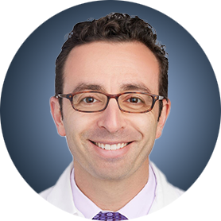
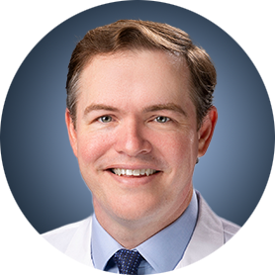

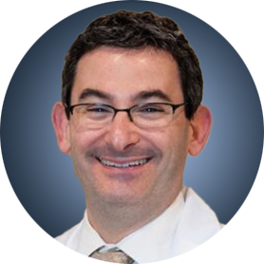
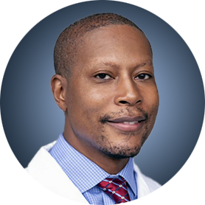
Faculty
Joshua Brody, MD
Director, Lymphoma Immunotherapy Program
The Tisch Cancer Institute at Mount Sinai
Faculty Member, Icahn Genomics Institute
Icahn School of Medicine at Mount Sinai
New York, New York
Jason Westin, MD, MS, FACP, FASCO
Director, Lymphoma Clinical Research
Lead, Lymphoma and Myeloma Service Line
Professor, Department of Lymphoma and Myeloma
The University of Texas MD Anderson Cancer Center
Houston, Texas
Manali Kamdar, MD, MBBS
Associate Professor
Clinical Director of Lymphoma Services
Morton and Sandra Saffer Endowed Chair in Hematology Research
Division of Hematology, Hematologic Malignancies
University of Colorado Cancer Center
Aurora, Colorado
Moderator
Jeremy S Abramson, MD, MMSc
Director, Center for Lymphoma
Massachusetts General Hospital
Professor of Medicine
Harvard Medical School
Boston, Massachusetts
Tycel Phillips, MD, FASCO
Associate Professor, Division of Lymphoma
Department of Hematology and Hematopoietic Cell Transplantation
City of Hope Comprehensive Cancer Center
Duarte, California

Slide 3
Dr Brody — Disclosures
Faculty
No relevant financial relationships to disclose

Slide 4
Dr Kamdar — Disclosures
Faculty
Advisory Committees | AbbVie Inc, AstraZeneca Pharmaceuticals LP, BeOne, Bristol Myers Squibb, Genentech, a member of the Roche Group
Data and Safety Monitoring Boards/Committees | Bristol Myers Squibb, Celgene Corporation, Genentech, a member of the Roche Group

Slide 5
Dr Phillips — Disclosures
Faculty
Advisory Boards/Consulting | AbbVie Inc, ADC Therapeutics, AstraZeneca Pharmaceuticals LP, BeOne, Bristol Myers Squibb, Caribou Biosciences Inc, Celgene Corporation, Genentech, a member of the Roche Group, Genetics Pharmaceuticals, Genmab US Inc, Incyte Corporation, Ipsen Biopharmaceuticals Inc, Janssen Biotech Inc, Johnson & Johnson, Kite, A Gilead Company, Lilly, Merck, Pfizer Inc, Pharmacyclics LLC, an AbbVie Company, Seagen Inc, Xencor
Advisory Committees | BeOne, Genentech, a member of the Roche Group, Genmab US Inc, Merck
Contracted Research | AbbVie Inc, Bristol Myers Squibb, Genentech, a member of the Roche Group, Sobi
Data and Safety Monitoring Boards/Committees | Xencor
Nonrelevant Financial Relationships | Blood Cancer United

Slide 6
Dr Westin — Disclosures
Faculty
Advisory Committees | Genentech, a member of the Roche Group, Kite, A Gilead Company, Novartis
Consulting Agreements | AbbVie Inc, ADC Therapeutics, Allogene Therapeutics, AstraZeneca Pharmaceuticals LP, Bristol Myers Squibb, Genentech, a member of the Roche Group, Genmab US Inc, Incyte Corporation, Janssen Biotech Inc, Kite, A Gilead Company, MorphoSys, Novartis, Nurix Therapeutics Inc, Pfizer Inc, Regeneron Pharmaceuticals Inc
Contracted Research | ADC Therapeutics, Allogene Therapeutics, AstraZeneca Pharmaceuticals LP, Bristol Myers Squibb, Genentech, a member of the Roche Group, Incyte Corporation, Janssen Biotech Inc, Kite, A Gilead Company, MorphoSys, Novartis, Nurix Therapeutics Inc, Regeneron Pharmaceuticals Inc

Slide 7
Dr Abramson — Disclosures
Moderator
Consulting Agreements | AbbVie Inc, ADC Therapeutics, AstraZeneca Pharmaceuticals LP, BeOne, Bristol Myers Squibb, Celgene Corporation, Foresight Diagnostics, Genentech, a member of the Roche Group, Gilead Sciences Inc, Interius BioTherapeutics, Miltenyi Biotec, Novartis, Roche Laboratories Inc, Seagen Inc
Contracted Research | Bristol Myers Squibb, Celgene Corporation, Cellectis, Genentech, a member of the Roche Group, Merck, Mustang Bio, Regeneron Pharmaceuticals Inc, Seagen Inc, Takeda Pharmaceuticals USA Inc

Slide 8
Research To Practice President Neil Love, MD — Disclosures
Dr Love is president and CEO of Research To Practice. Research To Practice receives funds in the form of educational grants to develop CME activities from the following companies: Aadi Bioscience, AbbVie Inc, ADC Therapeutics, Agendia Inc, Alexion Pharmaceuticals, Amgen Inc, Array BioPharma Inc, a subsidiary of Pfizer Inc, Arvinas, Astellas, AstraZeneca Pharmaceuticals LP, Aveo Pharmaceuticals, Bayer HealthCare Pharmaceuticals, BeOne, Biotheranostics Inc, A Hologic Company, Black Diamond Therapeutics Inc, Blueprint Medicines, Boehringer Ingelheim Pharmaceuticals Inc, Bristol Myers Squibb, Catalyst Pharmaceuticals Inc, Celcuity, Clovis Oncology, Coherus BioSciences, Corcept Therapeutics Inc, CTI BioPharma, a Sobi Company, Daiichi Sankyo Inc, Eisai Inc, Elevation Oncology Inc, Exact Sciences Corporation, Exelixis Inc, Genentech, a member of the Roche Group, Genmab US Inc, Geron Corporation, Gilead Sciences Inc, GSK, Helsinn Therapeutics (US) Inc, ImmunoGen Inc, Incyte Corporation, Ipsen Biopharmaceuticals Inc, Jazz Pharmaceuticals Inc, Johnson & Johnson, Karyopharm Therapeutics, Kite, A Gilead Company, Kura Oncology, Legend Biotech, Lilly, MEI Pharma Inc, Merck, Mersana Therapeutics Inc, Mirati Therapeutics Inc, Mural Oncology Inc, Natera Inc, Novartis, Novartis Pharmaceuticals Corporation on behalf of Advanced Accelerator Applications, Novocure Inc, Nuvalent, Nuvation Bio Inc, Pfizer Inc, Pharmacyclics LLC, an AbbVie Company, Puma Biotechnology Inc, Regeneron Pharmaceuticals Inc, Revolution Medicines Inc, Rigel Pharmaceuticals Inc, R-Pharm US, Sanofi, Seagen Inc, Servier Pharmaceuticals LLC, SpringWorks Therapeutics Inc, Stemline Therapeutics Inc, Sumitomo Pharma America, Summit Therapeutics, Syndax Pharmaceuticals, Taiho Oncology Inc, Takeda Pharmaceuticals USA Inc, TerSera Therapeutics LLC, and Tesaro, A GSK Company.

Slide 9
Commercial Support
This activity is supported by educational grants from Bristol Myers Squibb, Genentech, a member of the Roche Group, and Genmab US Inc.
Research To Practice CME Planning Committee Members,
Staff and Reviewers
Planners, scientific staff and independent reviewers for Research To Practice have no relevant financial relationships to disclose.

Slide 10
This educational activity contains discussion of
non-FDA-approved uses of agents and regimens. Please refer to official prescribing information for each product for approved indications.

Slide 11



Clinicians in the Meeting Room
Networked iPads are available.
Review Program Slides: Tap the Program Slides button to review speaker presentations and other program content.
Answer Survey Questions: Complete the pre- and postmeeting surveys. Survey questions will be discussed throughout the meeting.
Ask a Question: Tap Ask a Question to submit a challenging case or question for discussion. We will aim to address as many questions as possible during the program.
For assistance, please raise your hand. Devices will be collected at the conclusion of the activity.
Notes:
11

Slide 12

Clinicians Attending via Zoom
Review Program Slides: A link to the program slides will be posted in the chat room at the start of the program.
Answer Survey Questions: Complete the pre- and postmeeting surveys.
Ask a Question: Submit a challenging case or question for discussion using the Zoom chat room.
Get CME Credit: A credit link will be provided in the chat room at the conclusion of the program.
Notes:
12

Slide 13
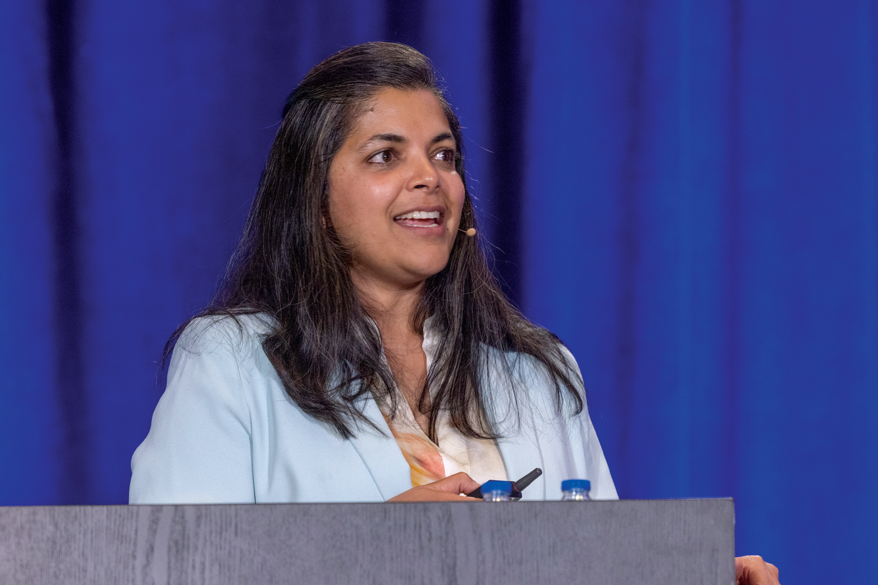
About the Enduring Program
The live meeting is being video
and audio recorded.
The proceedings from today will
be edited and developed into
an enduring web-based program.
An email will be sent to all attendees
when the activity is available.
To learn more about our education programs, visit our website, www.ResearchToPractice.com
Notes:
13
13

Slide 14
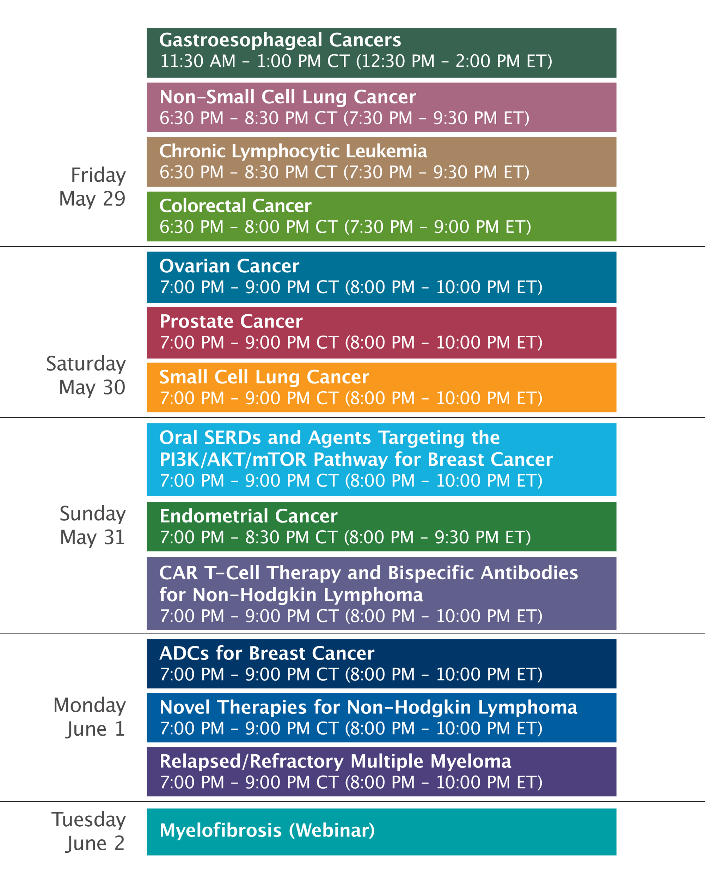

Slide 15
What Clinicians Want to Know: Addressing Community
Oncologists’ Questions About the Roles of CAR T-Cell Therapy and
Bispecific Antibodies in the Management of Non-Hodgkin Lymphoma
Sunday, May 31, 2026
7:00 PM – 9:00 PM CT (8:00 PM – 10:00 PM ET)
Faculty
Joshua Brody, MD
Manali Kamdar, MD, MBBS
Tycel Phillips, MD, FASCO
Jason Westin, MD, MS, FACP, FASCO
Moderator
Jeremy S Abramson, MD, MMSc

Slide 16
What Clinicians Want to Know: Addressing Community Oncologists’ Questions About the Roles of CAR T-Cell Therapy and Bispecific Antibodies in the Management of Non-Hodgkin Lymphoma
Survey of US-Based General Medical Oncologists
May 13-26, 2026

Slide 17
Agenda
Module 1: Chimeric Antigen Receptor (CAR) T-Cell Therapy for Diffuse Large B-Cell Lymphoma (DLBCL) — Dr Kamdar
Module 2: Bispecific Antibody Therapy for DLBCL — Dr Westin
Module 3: CAR T-Cell Therapy for Other Lymphoma Subtypes —
Dr Abramson
Module 4: Bispecific Antibody Therapy for Follicular Lymphoma and Other Lymphoma Subtypes — Dr Phillips
Module 5: Tolerability Considerations with CAR T-Cell Therapy and Bispecific Antibodies — Dr Brody

Slide 18
Agenda
Module 1: Chimeric Antigen Receptor (CAR) T-Cell Therapy for Diffuse Large B-Cell Lymphoma (DLBCL) — Dr Kamdar
Module 2: Bispecific Antibody Therapy for DLBCL — Dr Westin
Module 3: CAR T-Cell Therapy for Other Lymphoma Subtypes —
Dr Abramson
Module 4: Bispecific Antibody Therapy for Follicular Lymphoma and Other Lymphoma Subtypes — Dr Phillips
Module 5: Tolerability Considerations with CAR T-Cell Therapy and Bispecific Antibodies — Dr Brody

Slide 19
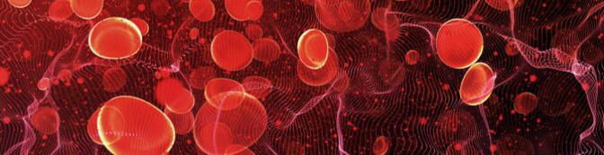
Chimeric Antigen Receptor (CAR) T-Cell Therapy for Diffuse Large B-Cell Lymphoma (DLBCL)
Manali Kamdar, MD, MBBS
Associate Professor of Medicine, Clinical director of lymphoma services,
Morton and Sandra Saffer Endowed Chair in Hematology Research, Division of Hematology,
University of Colorado
RTP, ASCO, 2026

Slide 20
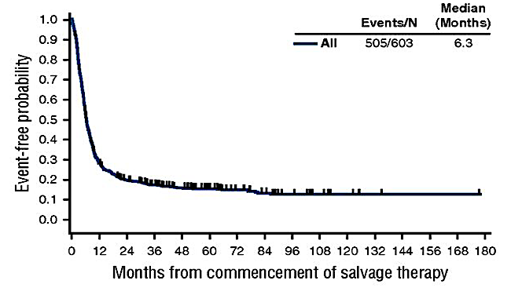
Pre-CAR-T ERA
Relapsed/Refractory Chemotherapy-resistant Large B Cell Lymphoma (R/R LBCL) → dismal prognosis
Crump et al Scholar-1 study Blood 2017

Slide 21
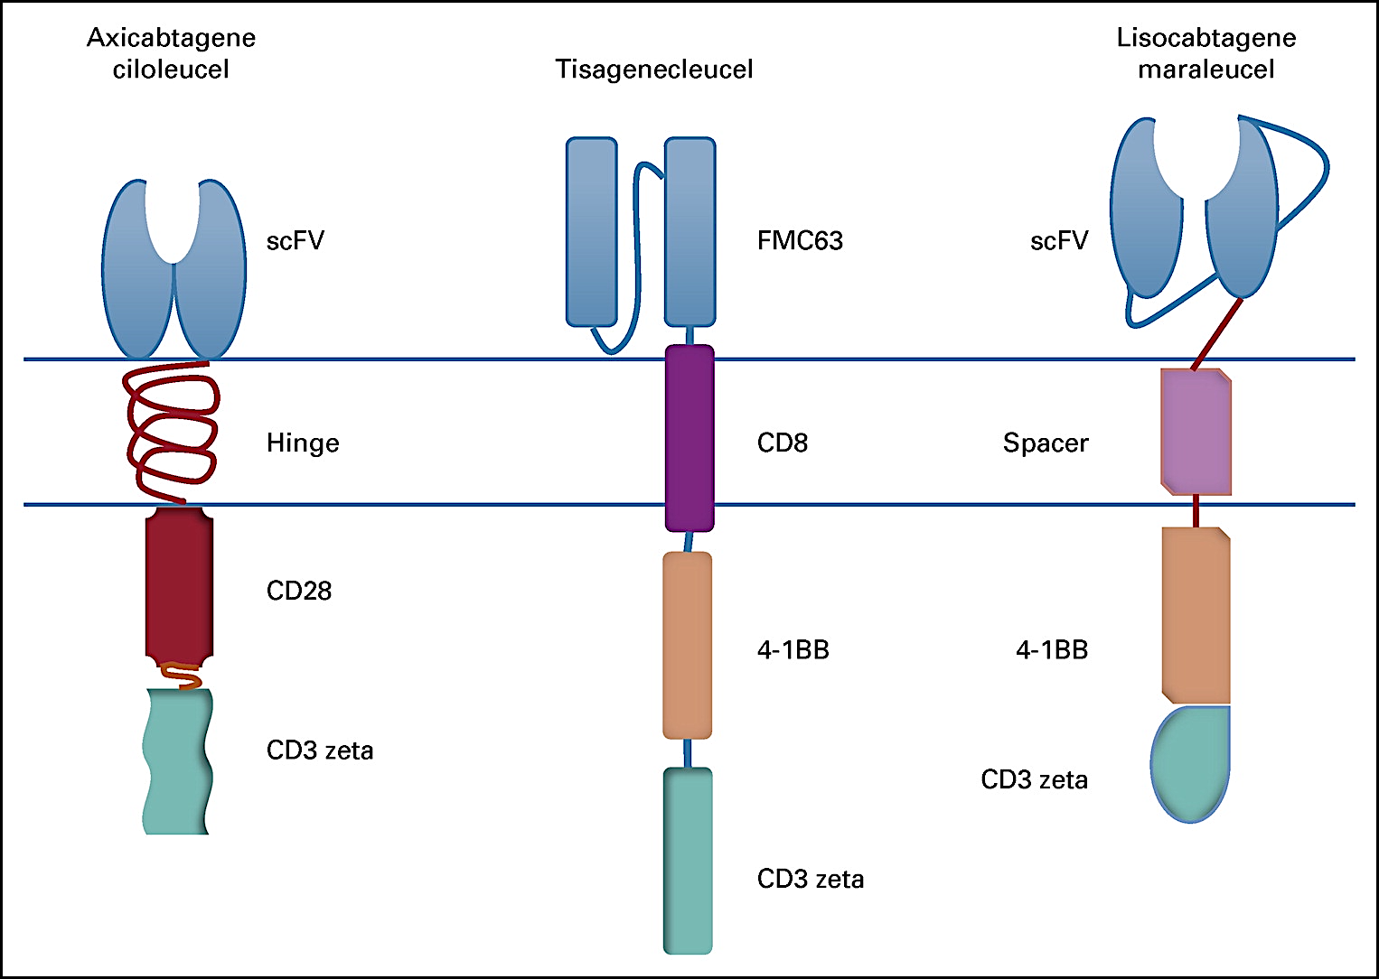
Anti-CD19 CAR-T cell therapies approved in R/R LBCL after failure of ≥2 lines of treatment
Axicabtagene ciloleucel
Tisagenlecleucel
Lisocabtagene maraleucel
Caron A. Jacobson; Journal of Clinical Oncology 2019

Slide 22
Baseline Characteristics
 | ZUMA-1 Axicabtagene Ciloleucel | TRANSCEND Lisocabtagene Maraleucel | JULIET Tisagenlecleucel
Dose | 2 x 10⁶/kg | 100 x 10⁶ | 0.6 to 6.0 x 10⁸
Lymphodepletion x3 days | Flu/Cy 500/30 | Flu/Cy 300/30 | Flu/Cy 250/25, OR Bendax2
# Treated / Enrolled | 101/111 | 269/344 | 111/165
Bridging Rx (%) | 0 | 59 | 92
Lymphoma Subtypes | DLBCL, PMBCL, HGBCL, Transformed FL | DLBCL, PMBCL, HGBCL, Transformed FL, Transformed Non-FL, Sec CNS involvement, Prior Allo | DLBCL, Transformed FL
Median Age | 58 (23-76) | 63 (18-86) | 56 (22-76)
Median prior LOT | 3 | 3 | 2 (44%), 3 (31%)
Refractory/Prior ASCT (%) | 100/23 | 67/35 | 55/49
Locke FL, et al. Lancet Oncol. 2019;20:31-42
Schuster, et al. Lancet Onc. 2021
Abramson JS, et al. Lancet 2020

Slide 23
Efficacy and Safety
 | ZUMA-1 Axicabtagene Ciloleucel | TRANSCEND Lisocabtagene Maraleucel | JULIET Tisagenlecleucel
# Treated / Enrolled | 101/111 | 269/344 | 111/165
ORR/CR (%) by IRC | 74/54 | 73/53 | 52/40
Construct | antiCD19-CD28-CD3z | antiCD19-41BB-CD3z | antiCD19-41BB-CD3z
Toxicity grading scale | Lee Criteria | Lee Criteria | Penn Criteria
Median time to CRS onset | 2 days | 5 days | 3 days
Any Grade/Gr ≥3 Cytokine release syndrome (CRS) | 93% / 11% | 42% / 2% | 58% / 23%
Any Gr/Gr ≥3 Neurotoxicity | 64% / 32% | 30% / 10% | 21% / 12%
2yr PFS/OS | 42% / 51% | 41% / 51% | 30%/median 11m
Locke FL, et al. Lancet Oncol. 2019;20:31-42
Schuster, et al. Lancet Onc. 2021
Abramson JS, et al. Lancet 2020

Slide 24
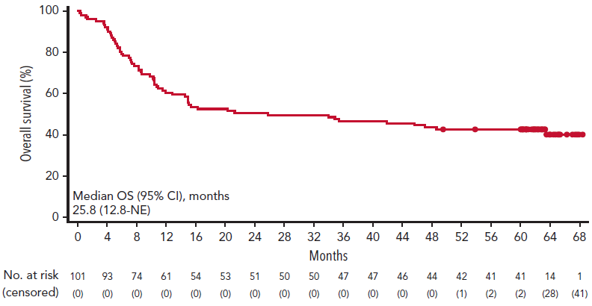
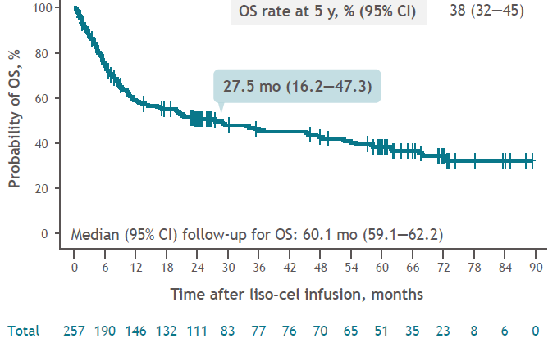
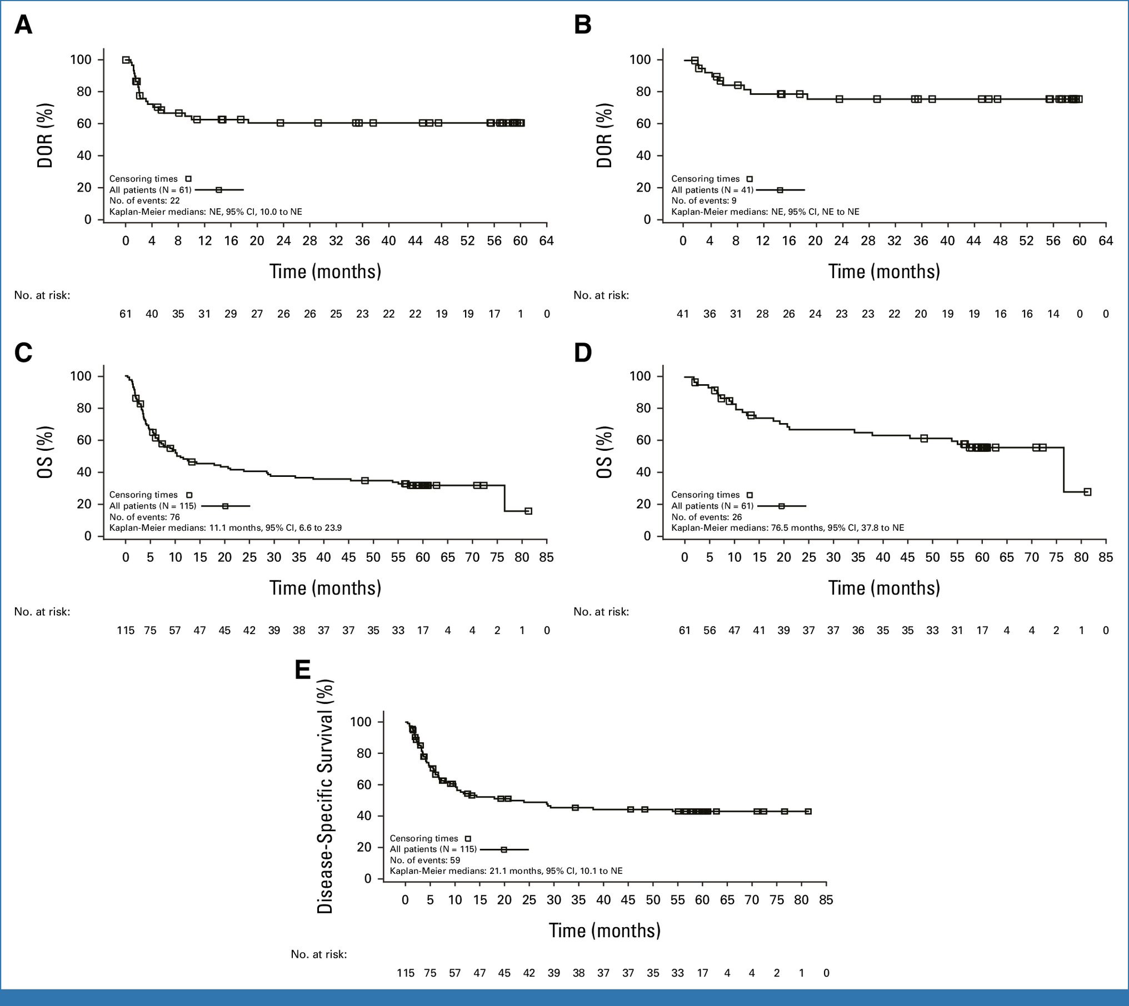
Long-term follow-up supports the curative potential of CD19 CAR T in R/R 3L+ LBCL
ZUMA-1 (axi-cel)¹
TRANSCEND (liso-cel)²
JULIET (tisa-cel)³
Overall survival
Overall survival
Overall survival
OS, %
OS, %
OS, %
Median OS:
25.8 months (95% CI = 12.8 months, NE)
Median OS:
27.5 months (95% CI = 16.2, 47.3 months)
Time, months
Time, months
Time, months
Median OS:
11.1 months (95% CI = 6.6, 23.9 months)
5-year OS rate: 43%
Median follow-up: 63.1 months
5-year OS rate: 38%
Median follow-up: 60.1 months
5-year OS rate: 32%
Median follow-up: 74.3 months
Inter-trial comparisons should not be made due to differences in study design, patient populations, treatment interventions, and durations of follow-up, among others. We cannot make direct comparisons or draw conclusions from one trial to another. For descriptive purposes, efficacy and safety results for each of the studies mentioned are listed.
3L, third line; axi-cel; axicabtagene ciloleucel; CAR, chimeric antigen receptor; LBCL, large B-cell lymphoma; liso-cel, lisocabtagene maraleucel; NE, not estimable; OS, overall survival, R/R, relapsed or refractory ; tisa-cel, tisagenlecleucel. 1. Neelapu SS, et al. Blood 2023;141:2307—2315. 2. Abramson JS, et al. ASH 2024. Abstract 3125. 3. Maziarz RT et al. J Clin Oncol. 2026 Jan 10;44(2):86-91.

Slide 25
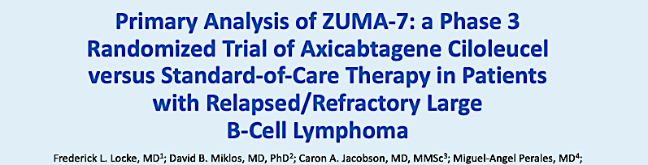
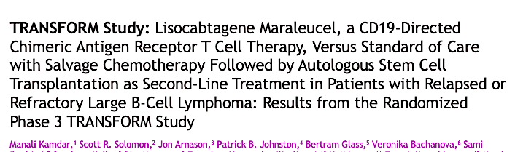
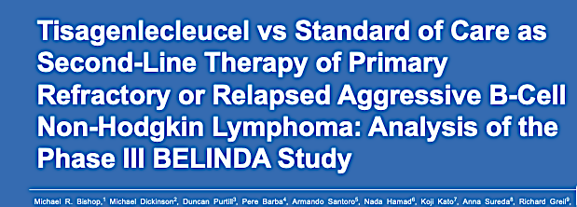
3 Randomized trials of CAR T-cell therapy vs SOC in transplant-eligible DLBCL with early relapse or primary refractory disease
ASH 2021
ASH 2021
ASH 2021
Locke, F et al, N Engl J Med. 2022 Feb 17;386(7):640-654. doi: 10.1056/NEJMoa2116133
Kamdar, M et al Lancet. 2022 Jun 18;399(10343):2294-2308. doi: 10.1016/S0140-6736(22)00662-6.
Bishop, M et al N Engl J Med. 2022 Feb 17;386(7):629-639. doi: 10.1056/NEJMoa2116596

Slide 26
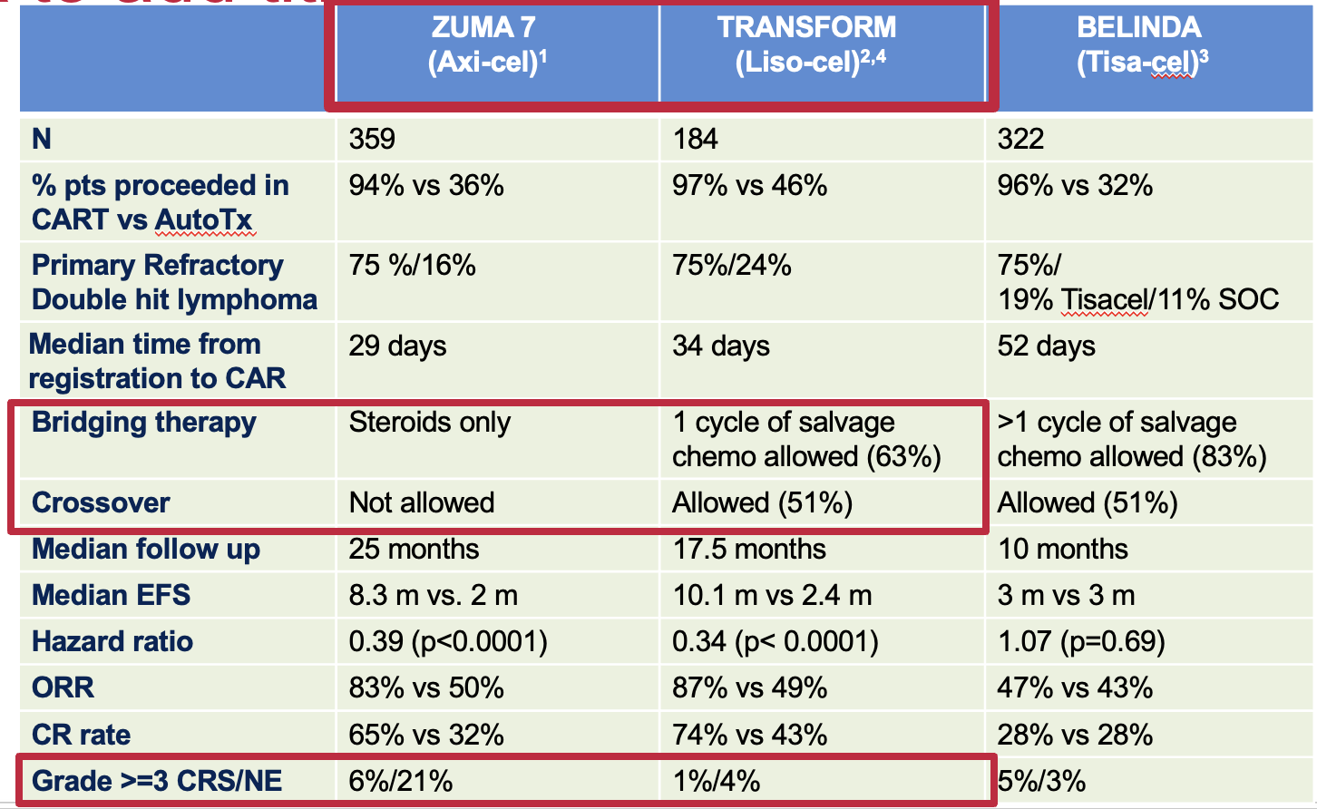
1.Locke, F et al, N Engl J Med. 2022 Feb 17;386(7):640-654. doi: 10.1056/NEJMoa2116133
2.Kamdar, M et al Lancet. 2022 Jun 18;399(10343):2294-2308. doi: 10.1016/S0140-6736(22)00662-6.
3.Bishop,M et al N Engl J Med. 2022 Feb 17;386(7):629-639. doi: 10.1056/NEJMoa2116596c
4.Abramson JS et al Blood 2023 6;141(14):1675-1684

Slide 27
Axi-cel continued to demonstrate higher rates of survival vs. SOC at ≈ 4 years of follow-up
OS (N = 359)²
Axi-cel efficacy (n = 180)^{1,2}
ZUMA-7^{1,2}
100
mFU: 47.2 months
Phase 3, randomized trial of axi-cel (n = 180) vs. SOC (ASCT, n = 179) as 2L treatment in patients with R/R LBCL (N = 359)
NR
Median OS
ORR, %
83ª
80
54.6%
48-Month OS
CRR, %
65^{b}
60
Axi-cel
48-mo EFS, %
39^{c}
OS, %
40
31.1
Median OS
SoC
Median EFS
11 months
46.0%
48-Month OS
Axi-cel
20
48-mo PFS, %
42^{d}
Primary refractory: 74%
HR= 0.73; p = 0.03
57% of patients received 3L cellular
immunotherapy crossover in the SOC arm
Median PFS
15 months
DHL/THL: 17%
0
0
6
12
18
24
30
36
42
48
54
60
0
100
Time, months
Significant improvement with axi-cel vs. SOC
Axi-cel provided a 27% reduction in risk of death vs. SOC²
ª ORR with SOC was 50%; ^{b} CRR with SOC was 32%; ^{c} 48-month EFS with SOC was 17%; ^{d} 48-month PFS with SOC was 24%. 2L, second line; ASCT, autologous stem cell transplant; axi-cel, axicabtagene ciloleucel; CRR, complete response rate; DHL, double-hit lymphoma; EFS, event-free survival; HR, hazard ratio; LBCL, large B-cell lymphoma; mFU, median follow-up; mo, month; NR, not reached; ORR, overall response rate; OS, overall survival; PFS, progression-free survival; R/R, relapsed or refractory; SOC, standard of care; THL, triple-hit lymphoma.
1. Locke FL, et al. N Engl J Med 2022;386:640—654. 2. Westin JR, et al. N Engl J Med 2023;389:148—157.
Notes:
Westin NEJM 2023 P148 citation B
Westin NEJM 2023 P148 citation A; Locke NEJM 2022 P641 citation A; P646 citation A & B table 1
Westin NEJM 2023 P150 citation C figure 1
Westin NEJM 2023 P153 citation A
Locke NEJM 2022 P646 citation B table 1
Westin NEJM 2023 P149 citation A
Westin NEJM 2023 P152 citation A figure 2B, P152 citation B Figure 2A

Slide 28
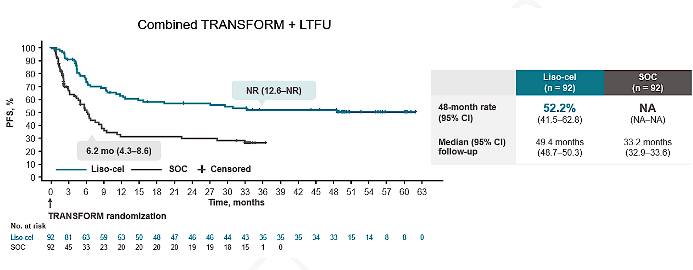
Liso-cel continued to demonstrate higher rates of survival at ≈ 3 and 4 years of follow-up
TRANSFORM^{1,2}
OS (N = 184)²
Liso-cel efficacy (n = 92)^{1,2}
100
NR
Median OS
mFU: 33.9 months
Phase 3, randomized trial of liso-cel (n = 92) vs. SOC (ASCT, n = 92) as 2L treatment in patients with R/R LBCL
(N = 184)
62.8%
36-Month OS
ORR, %
87
80
Liso-cel
CRR, %
74
60
36-mo EFS, %
46
OS, %
40
NR
Median OS
SOC
Median EFS
30 months
51.8%
36-Month OS
Liso-cel
20
36-mo PFS, %
51
Primary refractory: 73%
HR= 0.757
DHL/THL: 24%
0
Median PFS
Not reached
0
6
12
18
24
30
36
42
48
54
0
100
Time, months
Significant improvement with liso-cel vs. SOC
62% of patients crossed over from the SOC arm to receive liso-cel^{1,2}
Liso-cel provided a 43% reduction in risk of death vs. SOC in a prespecified analysis adjusted for crossover^{1,2,a}
Kamdar et al. ASH 2025; Kamdar et al. J Clin Oncol. 2025;43:2671-2678
Notes:
Kamdar ASCO 2024; Slide 11 citation A
Abramson_EHA 2024 Slide 3, 5; Kamdar ASCO 2024, Slide 4, slide 5 citation A
Kamdar ASCO 2024, slide 11 citation A; Abramson_EHA 2024 Slide 10 (KM curve right), slide 14 citation A
Abramson_EHA 2024 Slide 10 (KM curve right)
Kamdar ASCO 2024; Slide 6 citation A
Abramson_EHA 2024 Slide 6, slide 9
Abramson_EHA 2024 Slide 4, citation C

Slide 29
Receiving CAR-T in 2L versus 3L impacts outcomes
Figure 5. OS in liso-cel 2L (A) and liso-cel 3L (B) patients in the LTFU
(A)
NR (NR-NR)
 | Liso-cel 2L (liso-cel arm; n=43)
24-month rate (95% CI) | 95.1% (88.4-100.0)
Median (95% CI) follow-up in the LTFU | 17.1 months (16.1-21.9)
Liso-cel 2L
Censored
LTFU consent (up to 3 years after randomization)
No. at risk
Liso-cel 2L | 43 | 40 | 40 | 40 | 37 | 35 | 19 | 16 | 8 | 6 | 0
(B)
NR (NR-NR)
 | Liso-cel 3L (SOC crossover; n=24)
24-month rate (95% CI) | 78.3% (61.4-95.1)
Median (95% CI) follow-up in the LTFU | 35.0 months (28.8-37.1)
Liso-cel 3L
Censored
LTFU consent (up to 12 months after liso-cel infusion)
No. at risk
Liso-cel 3L | 24 | 23 | 21 | 21 | 20 | 18 | 18 | 18 | 17 | 15 | 12 | 10 | 7 | 5 | 3 | 2 | 0
Kamdar et. al. ASCO 2024. Oral Presentation

Slide 30
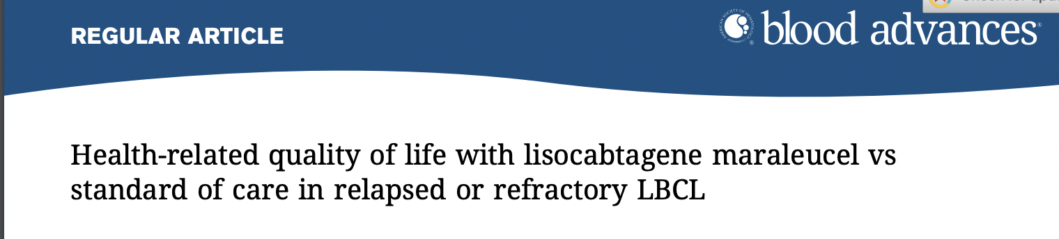
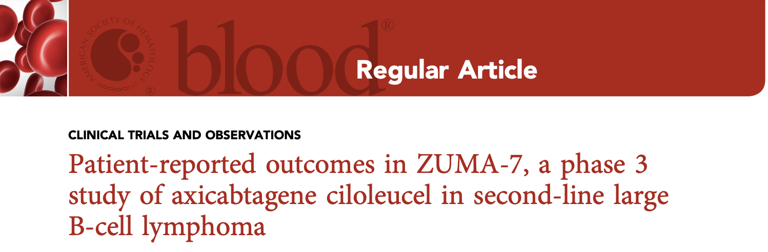
Patient-reported outcomes
The TRANSFORM and ZUMA-7 trials showed clinically meaningful improvement in quality of life for patients randomized to CAR T-cell therapy compared with ASCT^{1,2}
Liso-cel and axi-cel were approved for transplant-eligible high-risk DLBCL in first relapse^{3,4}
Next question: What about transplant ineligible YET CAR-eligible patients with R/R LBCL?
ASCT, autologous stem cell transplant; axi-cel, axicabtagene ciloleucel; CAR, chimeric antigen receptor; DLBCL, diffuse large B-cell lymphoma; LBCL, large B-cell lymphoma; R/R, relapsed or refractory.
1. Abramson J, et al. Blood Adv 2022;6:23:5969—5979. 2. Elsawy M, et al. Blood 2022;140:2248—2260. 3. Lisocabtagene maraleucel PI 2026. Axicabtagene ciloleucel PI. 2026.
4. Axicabtagene ciloleucel. Summary of product characteristics. Giliead Sciences; 2024.
Notes:
Abramson Blood Adv 2022 p5977 citation A
Abramson Blood Adv 2022 p5969 citation A (title)
Elsawy Blood 2022 p1 citation A (title)
Elsawy Blood 2022 p2 citation A (key points)
Breyanzi SmPC p3 citation A
Yescarta SmPC p2 citation A

Slide 31
PILOT study : Liso-cel demonstrated outcomes comparable to those in TRANSFORM in an ASCT-ineligible population
OS (N = 61)^{2,c}
AESIs (N = 61)²
PILOT
ASCT ineligibility criteria | Liso-cel, % (N = 61)
Age ≥ 70 years | 79
ECOG PS 2 | 26
CrCl < 60 mL/min | 25
DL_{CO} ≤ 60% | 7
LVEF < 50% | 2
100
CRS, %
2
38
mFU: 24.3 months
Phase 2, single-arm analysis assessing
liso-cel as 2L treatment in patients with R/R LBCL who were deemed ineligible for ASCTª (N = 61)^{1,2}
NR
Median OS
80
NEs, %
5
31
60
Day 29 cytopenia, %
85^{d}
OS, %
59%
18-mo OS rate
40
Infection (≤ 90 days), %
7
20
0
100
ORR: 80%^{2,b}
0
Deaths due to infection: 2%
0
6
12
18
24
30
36
All grades
Grade ≥ 3
Time, months
Median OS was not reached with liso-cel at ≈ 2-year median follow-up²
Liso-cel is not approved in Europe for the 2L treatment of DLBCL in patients who experienced relapse more than 12 months after completion of 1L therapy.
ª Patients must have also met at lease one transplant-not-intended criterion as determined by the investigator: age ≥ 70 years, ECOG PS of 2, DLCO ≤ 60%, LVEF < 50%, CrCl < 60 mL/min, ALT/AST > 2 × ULN; ^{b} Median follow-up of 12.3 months; ^{c} OS data include data from the LTFU study; ^{d} Prolonged cytopenia is defined as Grade ≥ 3 decreased hemoglobin level, neutrophil count or platelet count at the Day 29 visit as confirmed by laboratory results. 1L, first line; 2L, second line; AESI, adverse event of special interest; ALT, alanine transaminase; ASCT, autologous stem cell transplant; AST, aspartate aminotransferase; CrCl, creatinine clearance; CRS, cytokine release syndrome; DL_{CO}, diffusing capacity of the lungs for carbon monoxide; ECOG PS, Eastern Cooperative Oncology Group performance status; LBCL, large B-cell lymphoma; liso-cel, lisocabtagene maraleucel; LTFU, long-term follow up; LVEF, left ventricular ejection fraction; mFU, median follow-up; mo, month; NE, neurologic events; NR, not reached; ORR, overall response rate; OS, overall survival; R/R, relapsed or refractory, ULN, upper limit of normal. 1. Sehgal A, et al. Lancet Oncol 2022;23:1066—1077. 2. Sehgal A, et al. ASH 2023 Oral presentation 105.
Notes:
Seghal ASH 2023, slide 6, citation A
Seghal ASH 2023, slide 11 citation A, Slide 12 citation A
Seghal ASH 2023, slide 2, citation A, Slide 3 citation A; slide 4 citation A
Seghal ASH 2023, slide 5, citation A
Seghal ASH 2023, slide 9 citation A
Seghal ASH 2023, slide 9 citation A
Seghal Lancet Oncol 2022, p1067 citation A

Slide 32
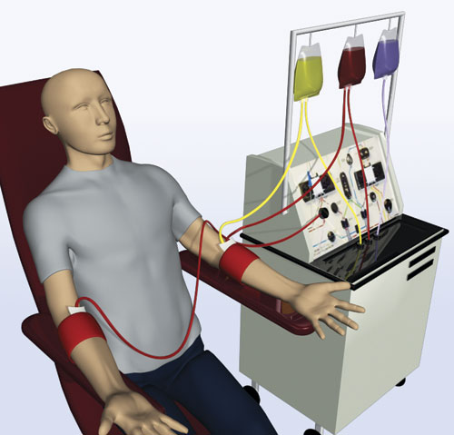
Logistics: THE PROCESS
Manufacturing
Apheresis¹⁻³
Bridging¹⁻³
CAR T infusion and management^{1,2}
Washout of prior medications
Patients undergo apheresis (collection of WBCs)
Optional bridging therapy to maintain disease control during CAR T-cell manufacturing
LDC administered prior to CAR T-cell infusion followed by infusion at the certified treatment center
Depends upon extent of disease
(chemotherapy vs. RT)
CAR, chimeric antigen receptor; LDC, lymphodepleting chemotherapy; RT, radiotherapy; WBC, white blood cell.
1. Beaupierre A, et al. J Adv Pract Oncol 2019; 10:29—40. 2. Beaupierre A, et al. Clin J Oncol Nurs 2019; 23:27—34. 3. McGuirk J, et al. Cytotherapy 2017; 19:1015—1024.
Notes:
Beaupierre
(J Adv Prac Oncol 2019); p32 citation A
Beaupierre
(Clin J Oncol Nurs 2019); p29 citation A
McGuirk 2017
(Cytotherapy); p1017 citation A
Beaupierre
(J Adv Prac Oncol 2019); p33 citation A
McGuirk 2017
(Cytotherapy); p1020 citation A (column 2 (bridging therapy)
Beaupierre
(J Adv Prac Oncol 2019); p34 citation A
Beaupierre
(Clin J Oncol Nurs 2019); p29 citation B
Beaupierre
(Clin J Oncol Nurs 2019); p30 citation A (column 1 – bridging); citation B (column 2, par 1 & par 2)
Beaupierre
(Clin J Oncol Nurs 2019); P30 citation A

Slide 33
The biggest barrier to CAR-T is often not biology, it is delayed recognition
and delayed referral.
Why Early Referral Matters
Bridging Therapy
Referral should occur ASAP
“BRAIN” to “VEIN” time (courtesy
Dr Lunning)
Real-world analyses show substantial attrition before CAR-T access- Many patients are never referred despite eligibility (2/10 based on claims data)
Early Referral
improves access and planning
allows insurance approval, caregiver planning, and leukapheresis coordination
Telehealth and early specialist input can reduce delays
Therapy Considerations
Steroids
Radiation
Bispecific antibodies/T-cell engagers
Selected chemotherapy approaches
AVOID BENDAMUSTINE
Consult CAR-T specialists BEFORE bridging whenever possible

Slide 34
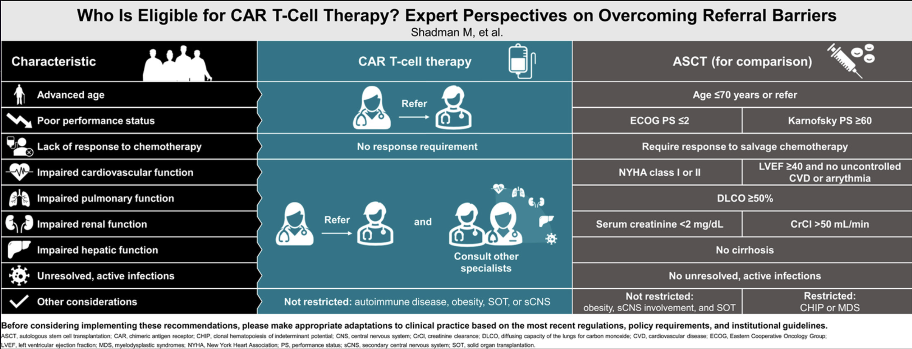
Determination of CAR-T eligibility
Several real-world studies¹ have shown that chronological age, comorbidities, or cognitive and/or functional impairments do not affect post-CAR T outcomes.
Automatic exclusion of patients based on age/comorbidities is not advised
Transplant eligibility ≠ CAR-T eligibility
2
“If a patient can tolerate lymphoma-directed therapy, they deserve CAR-T evaluation”
1.Major, Kamdar et al ASH Edu Program book 2023
2.Shadman et al. Cellular Therapy 2026;32:P277-287

Slide 35
CARs in the front-line setting: ZUMA-12 Study Design
Phase 2
High-Risk LBCL
HGBL, with MYC and BCL2 and/or BCL6 translocations (double- or triple-hit), or
LBCL with IPI score ≥3 any time before enrollment
Conditioning
Chemotherapy
+ Axi-Cel Infusion
Conditioning: Fludarabine 30 mg/m² IV and cyclophosphamide
500 mg/m² IV on Days −5, −4, and −3
Axi-Cel: Single IV infusion of 2×10⁶
CAR T cells/kg on Day 0
Primary Endpoint
CR (investigator-assessed per Lugano 2014 classification)¹
Key Secondary Endpoints
ORR
DOR
EFS
PFS
OS
Safety
CAR T cells in blood and cytokine levels in serum
Dynamic Risk Assessment
Positive interim PET (DS 4 or 5) after
2 cycles of an anti-CD20 mAb + anthracycline-containing regimen
Enrollment/Leukapheresis
Optional Nonchemotherapy Bridging Therapyª
Additional Key Inclusion Criteria
Age ≥18 years
ECOG 0–1
Chavez et al Blood 2025

Slide 36
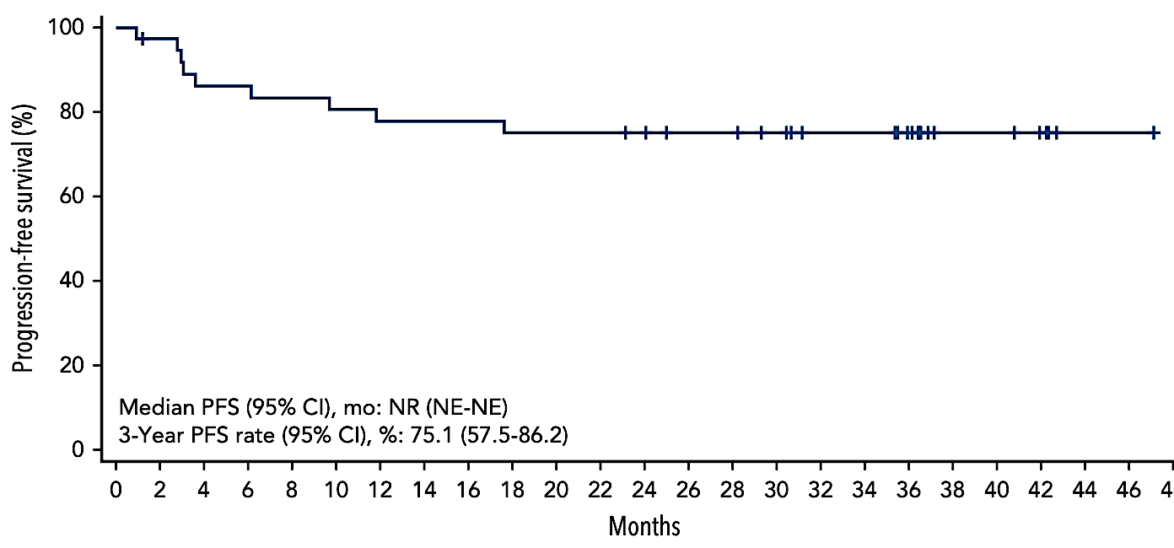
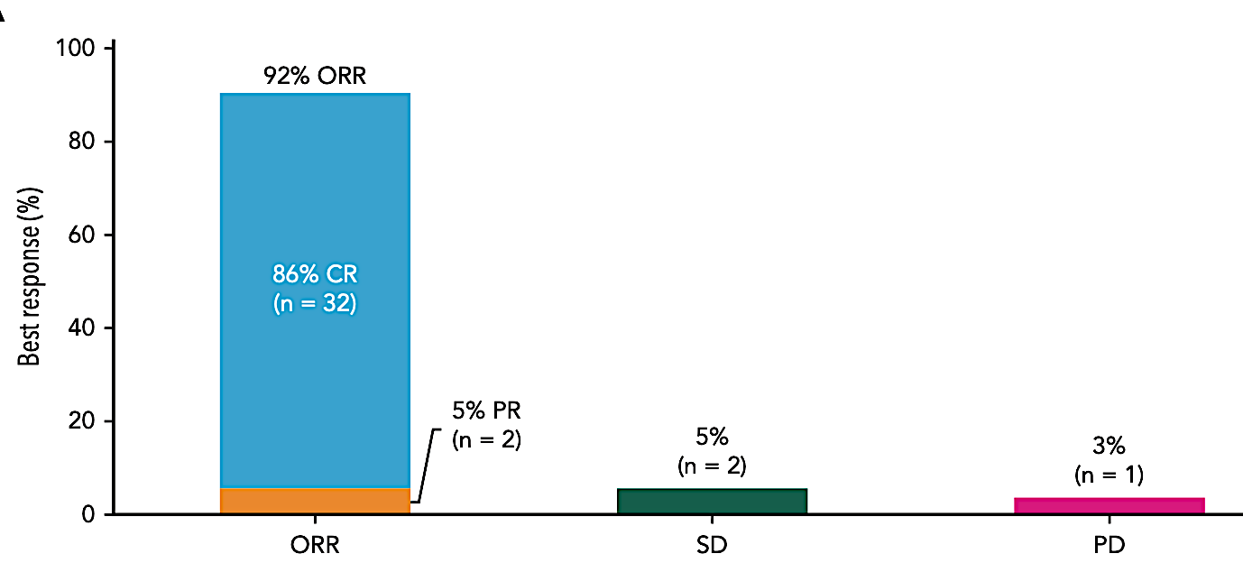
ORR 89% and CR Rate 78%
ZUMA-12 : Efficacy/Safety
The most common axi-cel–related Grade ≥3 AEs were neutropenia (53%), anemia (30%), encephalopathy (15%) and thrombocytopenia (15%)
CRS : Any Grade: 100%, Grade 3/> 8%
No Grade 4 and 5 CRS occurred
NE: Any Grade 73%, Grade 3/>23%, 5% Grade 4
No Grade 5 NE occurred
78% CR
(n=29)
11% PR
(n=4)
3 yr PFS 75%; 3 yr OS 81%
Chavez et al Blood 2025

Slide 37

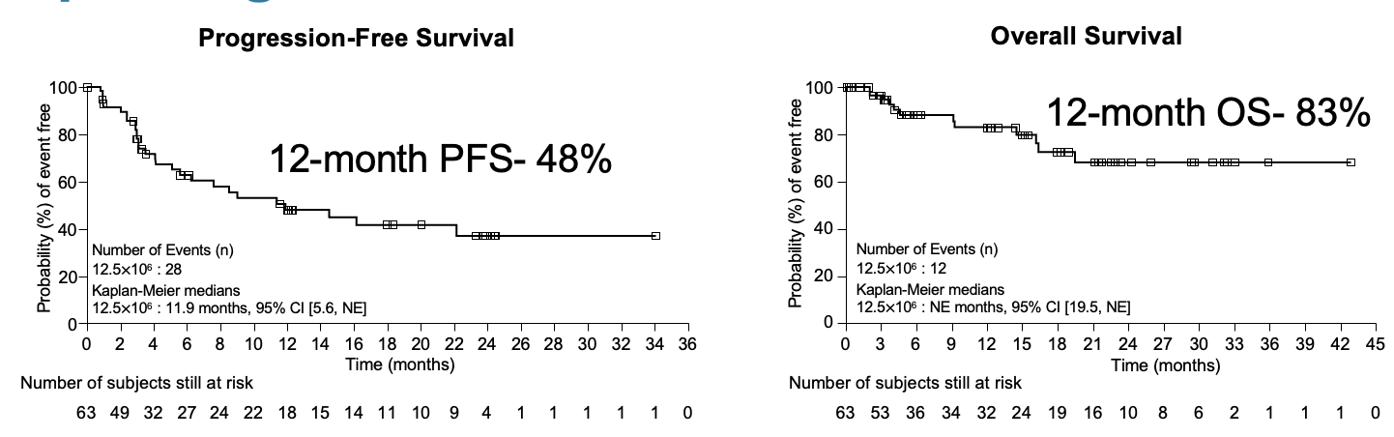
Early results with other CAR T-cell platforms in DLBCL
CD19-directed CAR-T cell therapy utilizes the T-Charge™ platform-preserve T-cell stemness + 2 day manufacturing time followed by release testing.
Phase Il study; 12.5×10⁶ CAR+ viable T-cell dose;
Primary Endpoint: Complete response rate (CR)
N=63, Median age 64, HGBCL -25% Refractory – 58%; mLOT- 2, BT- 60%
RESULTS
Median follow up 16 months
Primary Endpoint met- ORR 88% CR 62%
SAFETY
Most common cytopenias
CRS (44%)
Grade ≥3 CRS (6%) and ICANS (5%)
1 Grade 3 HLH,
Grade ≥3 infection 27%
Grade 5 – 6 patients ( 2 with PD)
2 doses of LD chemo tested
Lower dose n=28 Fly/Cy 25/250
Higher dose n=33 Flu/Cy 30/500
Risk-benefit analyses support lower-dose
Reidel et al ASH 2024 Abstract # 67

Slide 38
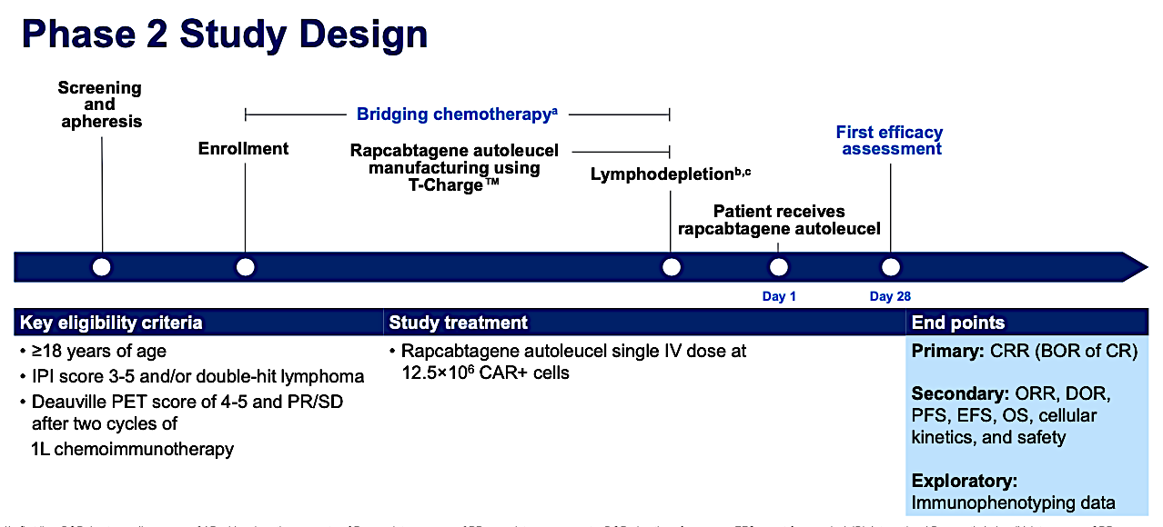
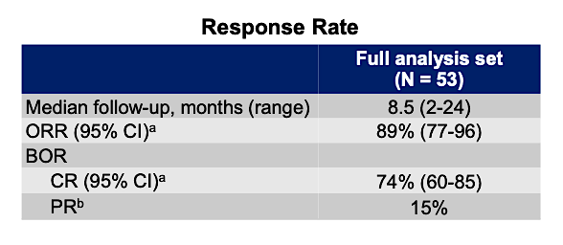
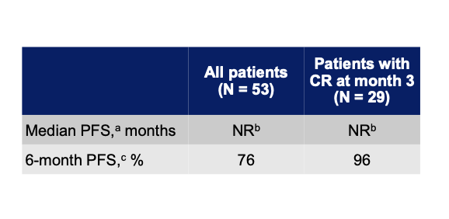
Rapcabtagene Autoleucel (YTB323) for Patients With First Line High-Risk Large B-Cell Lymphoma: Phase 2 Interim Results
N=53
SAFETY
Most common cytopenias
38% low grade CRS
No grade ≥3 CRS events
Median time to onset of CRS
10 days
8% ICANS, 2% Grade 3
Median time to onset 17 days
Westin et al ASH 2025

Slide 39
Beyond CD19: Early Clinical Signals with CD19/CD20 CAR-T Constructs
Trial (NCT) | Phase | N | Method (regimen/duration) | Primary Endpoint | Median Follow-Up | ORR | CR | Median PFS | Key ≥G3 toxicities / safety notes
LYL314 / IMPT-314 (NCT05826535) | 1/2 | 45, 31 eval | Dual CD19×CD20 CAR-T; CD62L+ enriched product; single infusion | Safety/ tolerability | 9 mos. | 94% | 74% | NR | CRS 62% (mostly low grade), ICANS ≥G3 13%, infections 13%
KITE-363 (NCT04989803) | 1 | 34 | Bicistronic CD19/CD20 CAR-T; single infusion | Toxicities and ORR | 7.3 mos. | 87% | 78% | NR | CRS ≥G3 3%, ICANS ≥G3 8%; no grade 4/5 CRS/ICANS
JNJ90014496 / CCAR039 (NCT05421663) | 1b | 42 | Bispecific anti-CD19/CD20 CAR-T; RP2D 75M CAR+ cells | Safety/ tolerability | 12 mos. | 90% | 76% | NR | No ≥G3 CRS/ICANS; ≥G3 neutropenia 68%
Next Wave of Trials – ENROLLING NOW!
Phase III RCTs comparing SOC CD19 CARs VERSUS CD19/20 CARs in 2L DBCL
Kamdar/Bartlett Blood 2026

Slide 40
Conclusion
The Path Forward
Move from center-based excellence → system-wide capability
Measure success by who receives CAR-T, not just who can deliver it
Align stakeholders—clinicians, payers, industry, and regulators—around access as a quality metric
The future of CAR-T is not just innovation it is implementation, scalability, and access.
Relapse should trigger referral because access to CAR-T may be access to cure.

Slide 41
Discussion Questions
80 y/o man with stage IV DLBCL, non-GCB subtype
PMH: coronary artery disease, stage 3 chronic kidney disease, atrial fibrillation on anticoagulation
R-CHOP as initial therapy with CR for 3 years; relapsed with nodal and extranodal disease
Tafasitamab/lenalidomide as second-line treatment with good response for 2 years; now with multifocal progressive disease
Would you recommend CAR T-cell therapy, a bispecific antibody or something else at this point? Which specific platform or agent/regimen would you select?

Slide 42
Discussion Questions (Questions)
80 y/o man with stage IV DLBCL, non-GCB subtype
PMH: coronary artery disease, stage 3 chronic kidney disease, atrial fibrillation on anticoagulation
R-CHOP as initial therapy with CR for 3 years; relapsed with nodal and extranodal disease
Tafasitamab/lenalidomide as second-line treatment with good response for 2 years; now with multifocal progressive disease
How does prior use of a CD19-directed approach influence your sequencing of available therapies, and do you conduct CD19 expression testing to assist in decision-making?
Would you consider palliative radiation or bridging therapy before instituting CAR-T or a bispecific?

Slide 43
Discussion Questions
65 y/o woman with stage 2 DLBCL
R-CHOP as initial therapy; recurrent disease at 13 months
Would you offer CAR-T over SCT in this situation? In general, what factors do you consider when making this decision? Has your enthusiasm for SCT waned at all given the effectiveness of CAR-T?
What are the advantages and disadvantages of the available CAR-T products? Would you have any preference for one platform versus the others for this patient?
53 y/o man with double-hit DLBCL
R-EPOCH as initial therapy; recurrent disease at 18 months
Although this patient is transplant eligible, is CAR-T a consideration?

Slide 44
Discussion Questions
67 y/o man with DLBCL
R-CHOP as initial therapy with rapid relapse
Poor performance status and logistics prevented CAR-T
GemOx + epcoritamab as second-line treatment
The patient would now be eligible for CAR-T — would you offer it if/when he progresses? Is the efficacy of CAR-T diminished after progression on a bispecific-based approach?

Slide 45
Agenda
Module 1: Chimeric Antigen Receptor (CAR) T-Cell Therapy for Diffuse Large B-Cell Lymphoma (DLBCL) — Dr Kamdar
Module 2: Bispecific Antibody Therapy for DLBCL — Dr Westin
Module 3: CAR T-Cell Therapy for Other Lymphoma Subtypes —
Dr Abramson
Module 4: Bispecific Antibody Therapy for Follicular Lymphoma and Other Lymphoma Subtypes — Dr Phillips
Module 5: Tolerability Considerations with CAR T-Cell Therapy and Bispecific Antibodies — Dr Brody

Slide 46
Bispecific Antibody Therapy for DLBCL
Jason Westin, MD, MS
Director, Lymphoma Clinical Research
Section Chief, Aggressive Lymphoma
Professor, Department of Lymphoma and Myeloma
The University of Texas MD Anderson Cancer Center
Houston, Texas

Slide 47
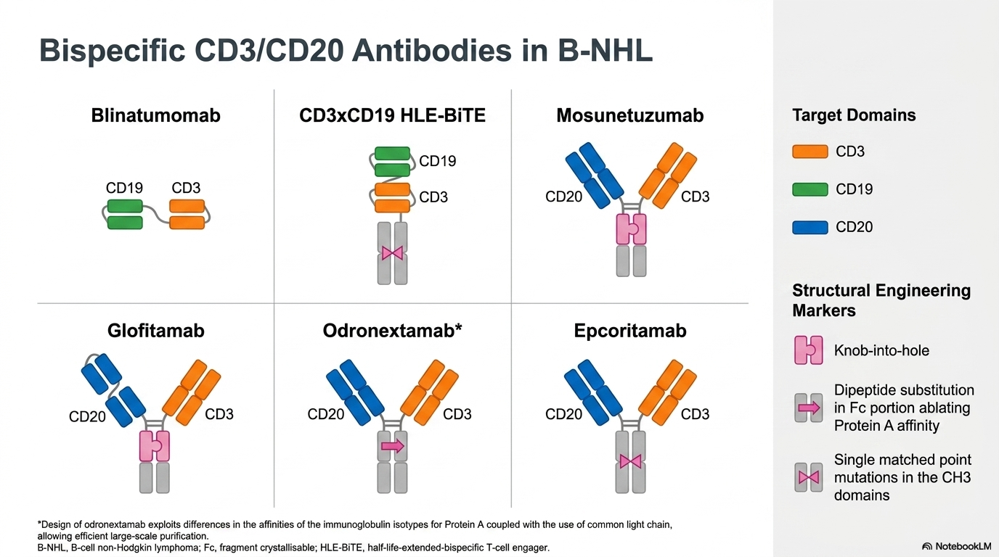
Adapted from Lussana et al, J Clin Oncol. 2021 Feb 10;39(5):444-455

Slide 48
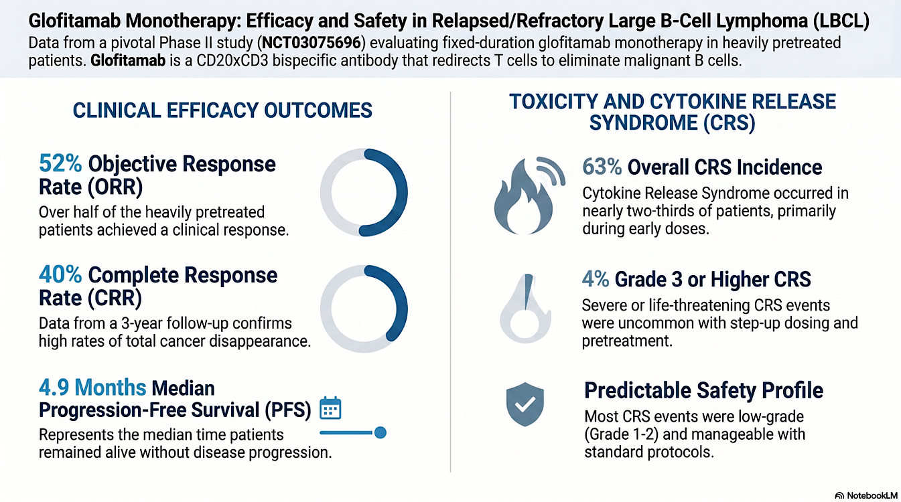
Dickinson et al NEJM 2022

Slide 49
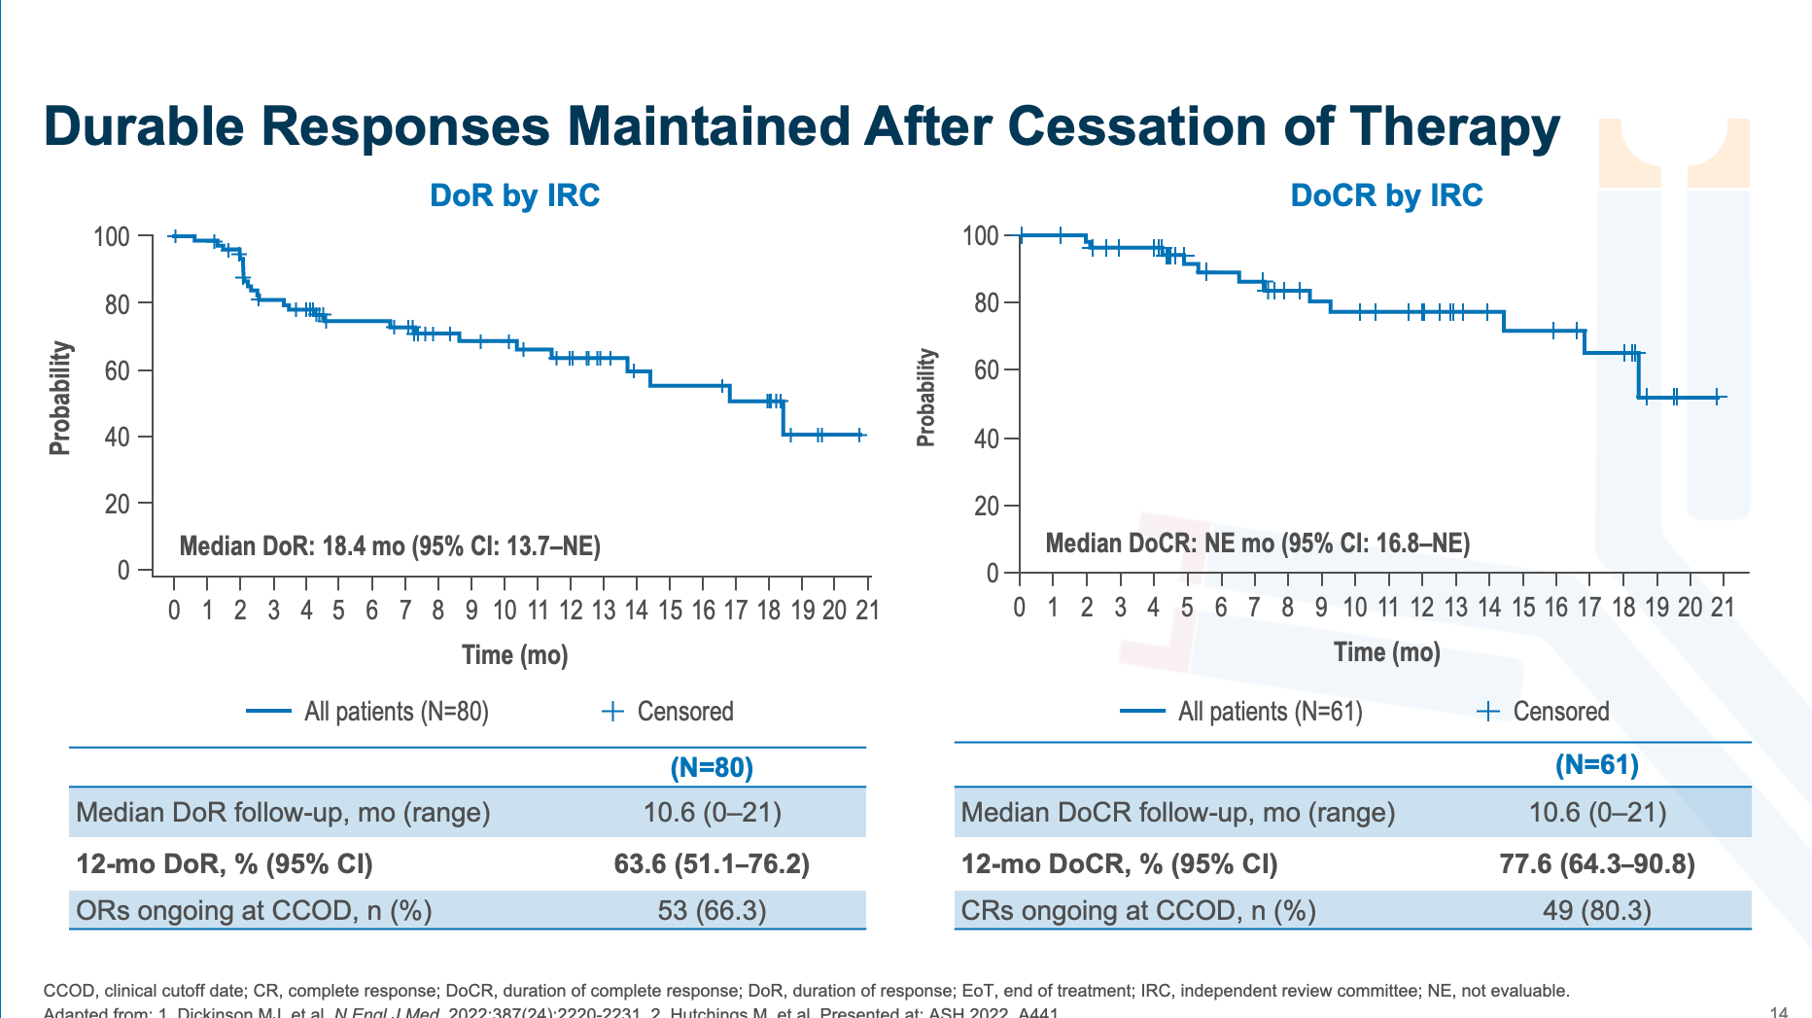

Slide 50
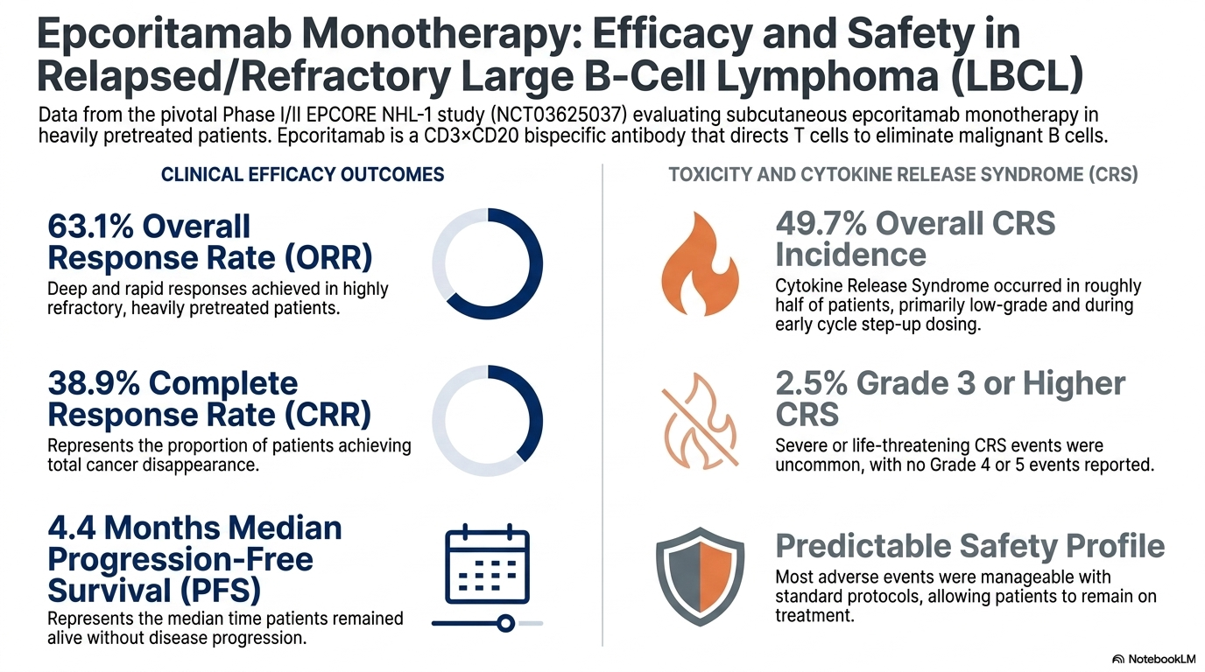
Thieblemont et al, JCO 2022

Slide 51
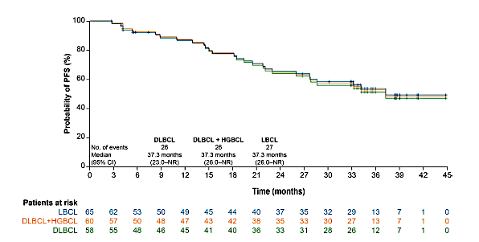
Durability of response to Epcoritamab
Karimi et al, Annals of Hematology 2026

Slide 52
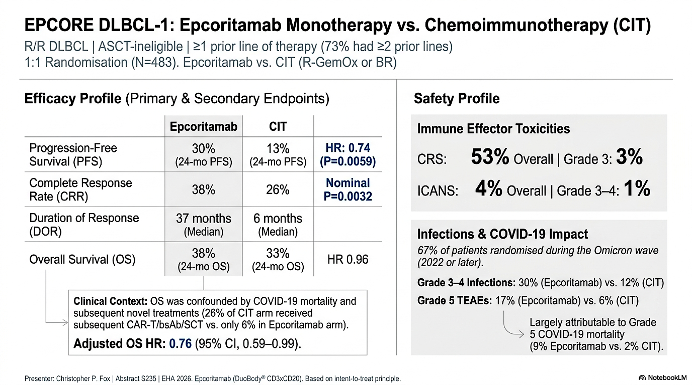

Slide 53
STARGLO (NCT04408638): A randomized, global, Phase III trial
Glofit-GemOx has shown clinically meaningful and statistically significant benefits in OS, PFS, and CR rate compared with R-GemOx in patients with ASCT-ineligible R/R DLBCL in the STARGLO trial¹
Glofit-GemOx (n=183)
Glofitamab
30mg on Day 1
of each cycle
Patients R/R DLBCL (N=274)
R/R DLBCL NOS after ≥1 prior systemic therapy
Patients with 1 prior line must be transplant ineligible
ECOG performance status 0–2
Glofitamab plus gemcitabine and oxaliplatin*
Glofitamab step-up dosing in Cycle 1,
30mg on Day 1 from Cycle 2 onwards
Cycles 9–12
R 2:1
Cycles 1–8
(21-day cycles)
Primary endpoint: OS
Key secondary endpoints:
PFS, CR rate, DoCR
(all IRC-assessed)
Safety endpoints:
incidence, nature, and severity of adverse events
R-GemOx (n=91)
Stratification factors
Relapsed vs refractory disease‡
1 vs ≥2 prior lines of therapy
Rituximab† plus gemcitabine and oxaliplatin Administered on Day 1 of each cycle
We present efficacy and safety in clinically relevant subgroups from STARGLO,
with 3 years of follow-up
*Gemcitabine 1000mg/m², oxaliplatin 100mg/m². In Cycle 1, obinutuzumab pretreatment administered on Day 1, GemOx on Day 2, Glofit 2.5mg on Day 8, Glofit 10mg on Day 15;
in Cycles 2–8, Glofit 30mg and GemOx administered on Day 1. †Rituximab 375mg/m². ‡Relapsed disease: recurrence after a response that lasted ≥6 months after completion of last line of therapy; refractory disease: disease that did not respond to, or that progressed <6 months after completion of last line of therapy. ASCT, autologous stem cell transplant;
CR, complete response; DLBCL, diffuse large B-cell lymphoma; DoCR, duration of complete response; ECOG, Eastern Cooperative Oncology Group; IRC, independent review committee; LOT, line of therapy; OS, overall survival; PFS, progression-free survival; R 2:1, randomized in a 2:1 ratio.
1. Abramson JS, et al. Lancet 2024;404:1940–54.

Slide 54
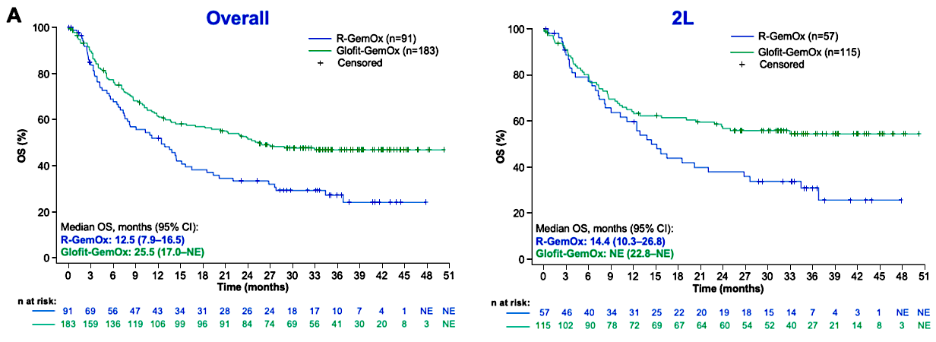
STARGLO OS at 3y
Abramson et al, ASH 2025

Slide 55
Landmark analysis by response at EOT in 2L patients treated with Glofit-GemOx
100
100
80
80
60
60
OS (%)
PFS (%)
40
40
20
20
0
0
0
6
12
18
24
30
36
42
0
6
12
18
24
30
Time (months)
Time (months)
Number of patients at risk:
Number of patients at risk:
55
50
49
40
30
17
5
NE
55
43
37
26
5
NE
18
8
7
7
3
1
NE
NE
14
NE
NE
NE
NE
NE
3
1
1
1
NE
NE
NE
NE
3
1
NE
NE
NE
NE
CR (n=55)
No response (n=18)
PR (n=3)
Censored
Landmark OS from EOT ​ in ​2L patients with CR at EOT​​ | n=55
Median OS, months (95% CI) ​​ | NR (NE)​​
24-month OS, % (95% CI) ​​ | 85.2 (75.7–94.7)​
Landmark PFS from EOT ​ in ​patients with CR at EOT​​ | n=55
Median PFS, months (95% CI) ​​ | NR (NE)​​
24-month PFS, % (95% CI) ​​ | 74.8 (60.9–88.7)
The majority of 2L patients who reached CR at EOT remained
alive and progression free 2 years after EOT
Data cut-off: May 1, 2025. EOT, end of treatment; PR, partial response.
Abdulhaq et al, ASH 2025

Slide 56
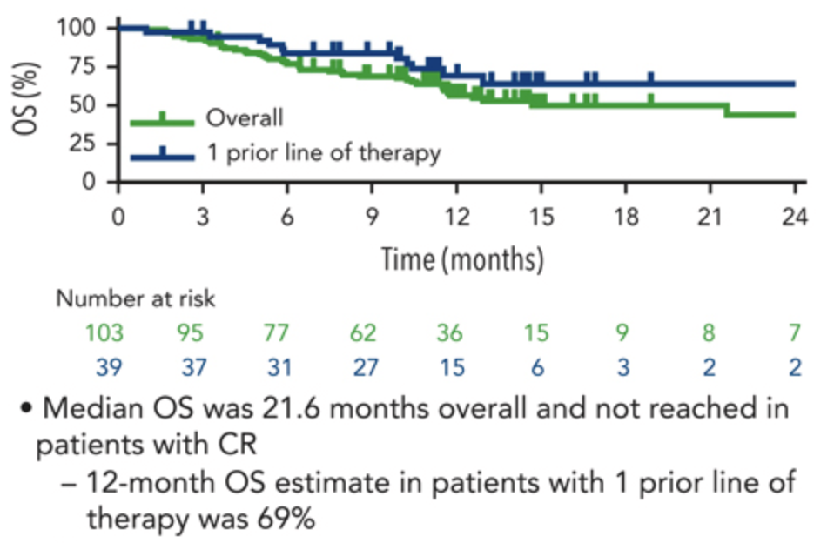
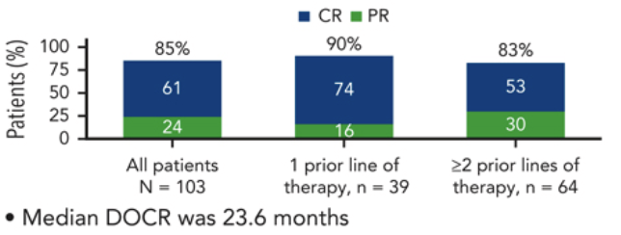
Phase Ib/II EPCORE NHL-2 Trial: Epcor-GemOx ≥ 2L R/R DLBCL
Response and Overall Survival
Brody et al Blood 2025;145:1621–1631
Notes:
Another 103 pt Phase 2 study of Epcor + Gem Ox with the green curve showing all pts regardless of line of therapy with a 12 mo PFS of 44%. For pts with only 1 prior line of therapy, 12 mo PFS 63%, this trend was also seen in the Starglo study with Glofit/GemOx…

Slide 57
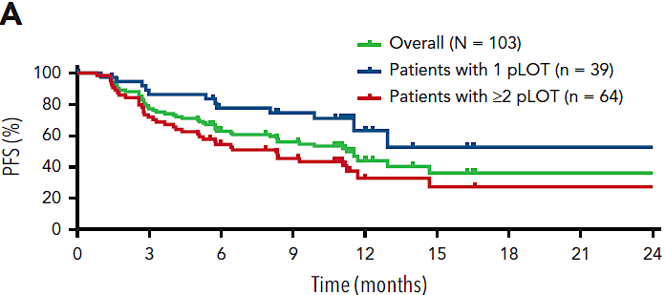
Phase Ib/II EPCORE NHL-2 Trial: Epcor-GemOx ≥ 2L R/R DLBCL
2nd vs later line of therapy significantly affected outcomes
12mo PFS 63%
12mo PFS 44%
12mo PFS 33%
Brody et al Blood 2025;145:1621–1631
Notes:
Another 103 pt Phase 2 study of Epcor + Gem Ox with the green curve showing all pts regardless of line of therapy with a 12 mo PFS of 44%. For pts with only 1 prior line of therapy, 12 mo PFS 63%, this trend was also seen in the Starglo study with Glofit/GemOx…

Slide 58
SUNMO Study design
Key eligibility
R/R LBCL with
≥1 prior therapy and ASCT-ineligible:
DLBCL NOS
Transformed FL
HGBCL
Grade 3B FL
Outpatient Mosun SC (8 cycles) + Pola IV (6 cycles) (21-day cycles)
Mosun
5mg
Mosun
45mg
Mosun
45mg
2:1
Screen
C1
D1 D8 D15
C2
C3
C4
C5
C6
C7
C8
Follow up after
drug completion
Screen | C1 D1 D8 D15 | C2 | C3 | C4 | C5 | C6 | C7 | C8 | Follow up after drug completion
Screening
8
weeks
16
weeks
24
weeks
…
9
months
…
30
months
R-GemOx IV (8 x 14–21-day cycles*)
Stratification factors
1 vs ≥2 prior lines of
systemic therapy
Relapsed vs refractory disease
Screen
C1
C2
C3
C4
C5
C6
C7
C8
Follow up after drug completion
Screen | C1 | C2 | C3 | C4 | C5 | C6 | C7 | C8 | Follow up after drug completion
Screening
8
weeks
16
weeks
24
weeks
…
9
months
…
30
months
*14-day cycles unless delayed to 21-day cycles if needed in case of hematologic toxicity.
C, cycle; D, day; DLBCL, diffuse large B-cell lymphoma; FL, follicular lymphoma;
HGBCL, high-grade B-cell lymphoma; IV, intravenous; NOS, not otherwise specified;
SC, subcutaneous.
Mosun
Pola
R-GemOx
Tumor
assessment
Presented as LBA3 by Westin et al, ICML 2025

Slide 59
Mosun-Pola continued to demonstrate a durable
PFS benefit after a median follow-up of 28.3 months
Primary endpoint: PFS by IRC in ITT
100
Mosun-Pola (n=138)
R-GemOx (n=70)
80
Censored
Median, months (95% CI):
Mosun-Pola: 11.6 (5.6–17.6)
R-GemOx: 3.8 (2.9–4.1)
HR (95% CI): 0.41 (0.28–0.60)
60
PFS (%)
40
20
0
0
3
6
9
12
15
18
21
24
27
30
33
36
No. of patients at risk
Time (months)
Mosun-Pola
138
108
67
59
51
43
39
33
23
16
5
1
NE
Clinical cut-off date: August 8, 2025.
PFS is censored at earliest of NALT or two or more missing tumor assessments, whichever occurred first.
CI, confidence interval; HR, hazard ratio; NALT, new anti-lymphoma therapy; NE, not evaluable.
Kim et al, ASCO 2026

Slide 60
Mosun-Pola demonstrated high efficacy in the 2L setting
IRC-assessed efficacy % (95% CI), unless otherwise stated | 2L Mosun-Pola (n=61) | 2L R-GemOx (n=30)
Median PFS, months (95% CI) | 17.6 (5.6–NE) | 3.6 (2.1–5.3)
ORR | 75.4 (62.7–85.5) | 36.7 (19.9–56.1)
CR | 60.7 (47.3–72.9) | 20.0 (7.7–38.6)
Median DOR, months (95% CI) | 18.8 (11.3–NE) | 6.0 (3.9–NE)
Median DOCR, months (95% CI) | NR (15.6–NE) | 21.4 (3.9–NE)
PFS by IRC: 2L
100
Mosun-Pola (n=61)
Median, months (95% CI):
Mosun-Pola: 17.6 (5.6–NE)
R-GemOx: 3.6 (2.1–5.3)
HR (95% CI): 0.38 (0.22–0.67)
80
R-GemOx (n=30)
Censored
60
PFS (%)
40
20
0
0
3
6
9
12
15
18
21
24
27
30
33
36
No. of patients at risk
Time (months)
Mosun-Pola
61
50
33
29
25
21
18
14
10
7
2
NE
NE
R-GemOx
30
17
5
3
3
3
3
3
2
1
NE
NE
NE
A PFS HR of 0.38 was demonstrated in the
2L population
  The 2-year PFS rate was doubled with Mosun-Pola versus R-GemOx: 40.3% vs 20.1%
  Median DOCR was not reached with Mosun-Pola
Clinical cut-off date: August 8, 2025.
Kim et al, ASCO 2026

Slide 61





R-Pola-Glo – Study Design
PET/CT
C2
C6
EOT
C2
C6
EOT
PET/CT
Pola
R
Glo
O
Glo
Pola
Glo
Glo
Cycle 1
Cycle 2-6
Cycle 7-12
Prephase
Debulking
Step-up
Target dose
Consolidation
Indication
Study Design
Endpoints
Untreated patients >60 yo with LBCL
Non-eligible for full dose R-CHOP
One-arm, multicenter phase II
30 centers in Germany and Austria
80 pts (C1-6 mandatory inpatient)
Mandatory prophylaxis
Primary: 1y-PFS rate
Secondary:
  Efficacy (OS, EFS)
  Feasibility/Toxicity

Slide 62
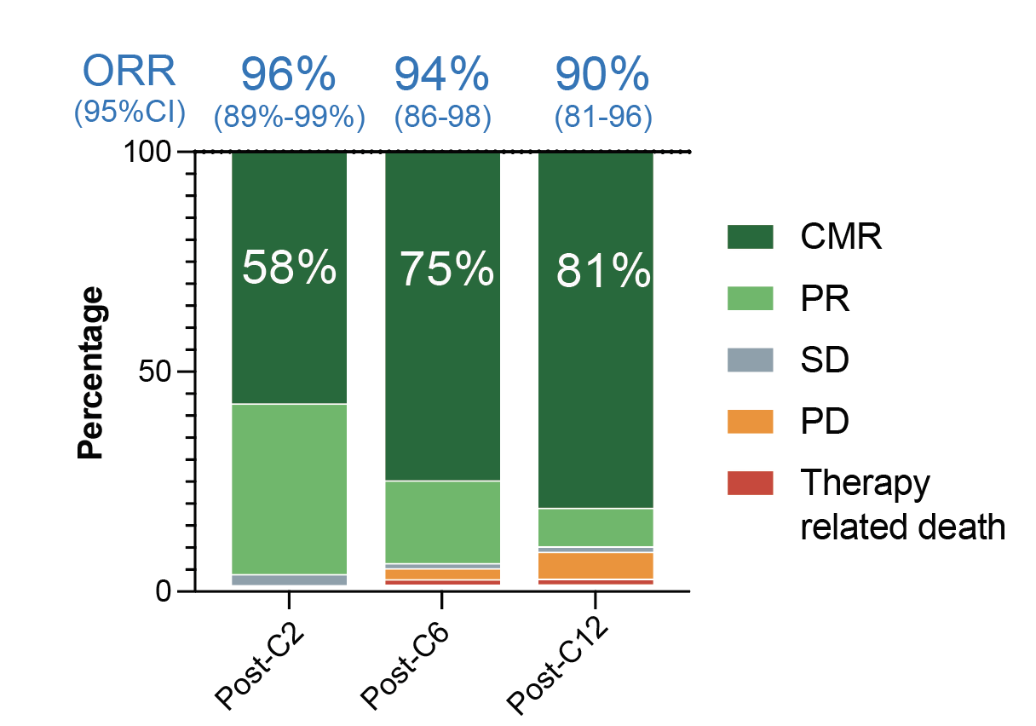
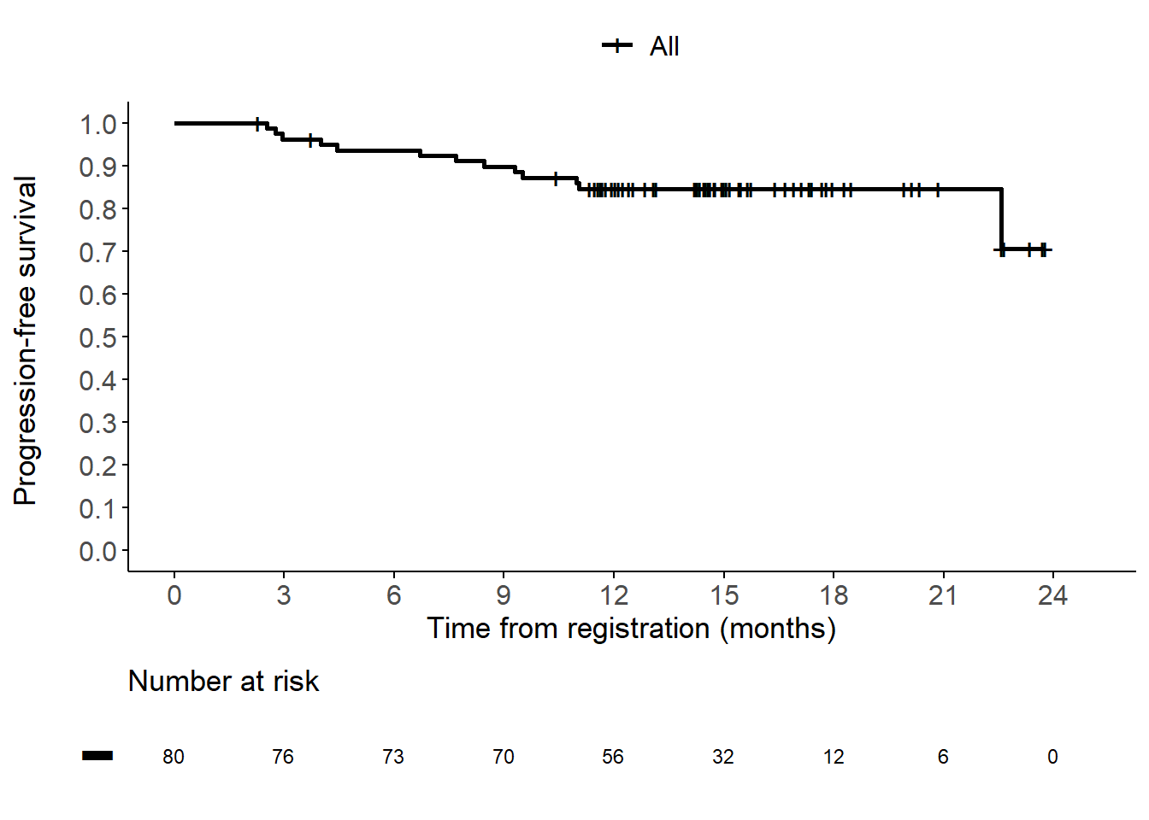
R-Pola-Glo – Outcome
1-year Progression-free Survival (PFS)
Chapuy et al, ASH 2025

Slide 63
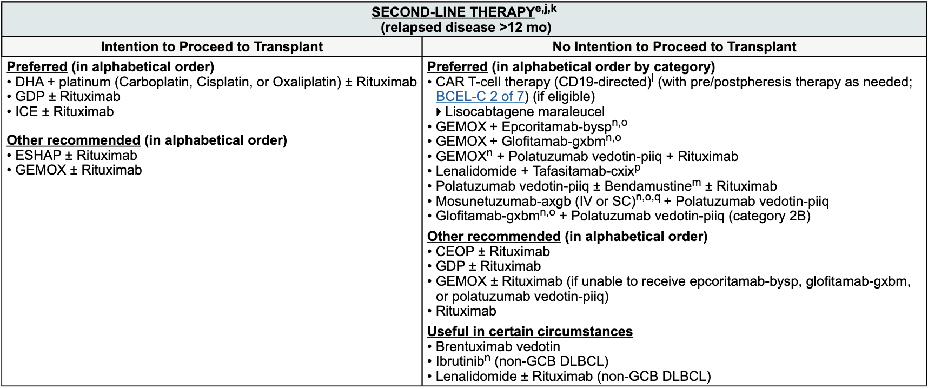
NCCN Suggested Treatment Regimens
NCCN Clinical Practice Guidelines in Oncology. B-Cell Lymphomas. Version 4.2026.

Slide 64
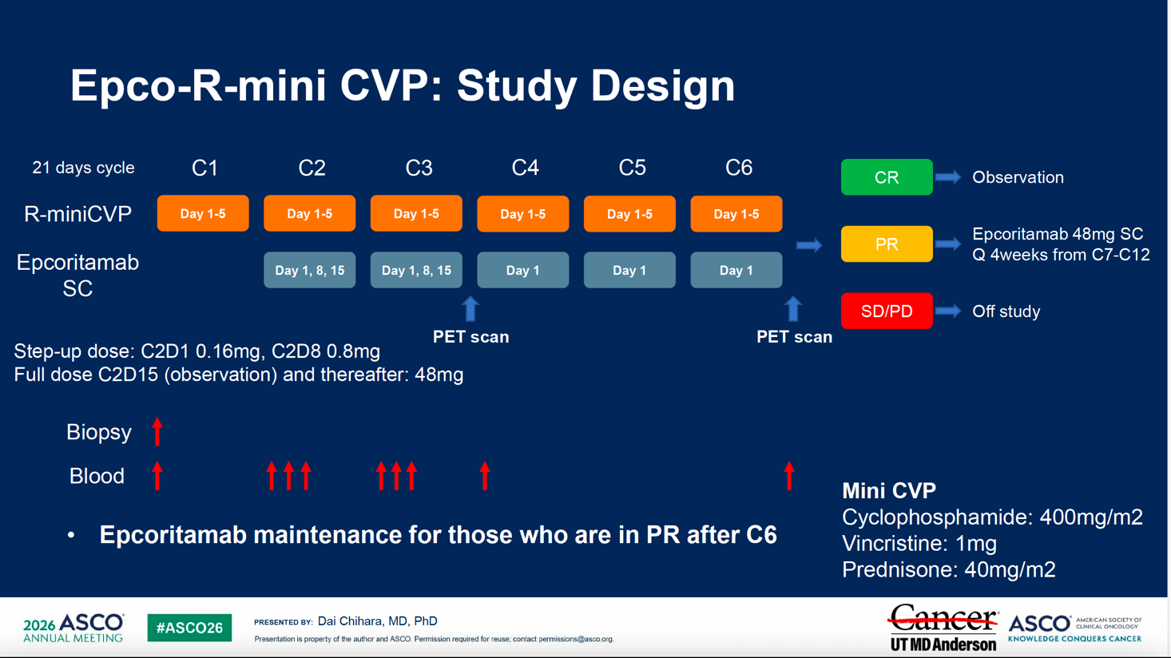

Slide 65
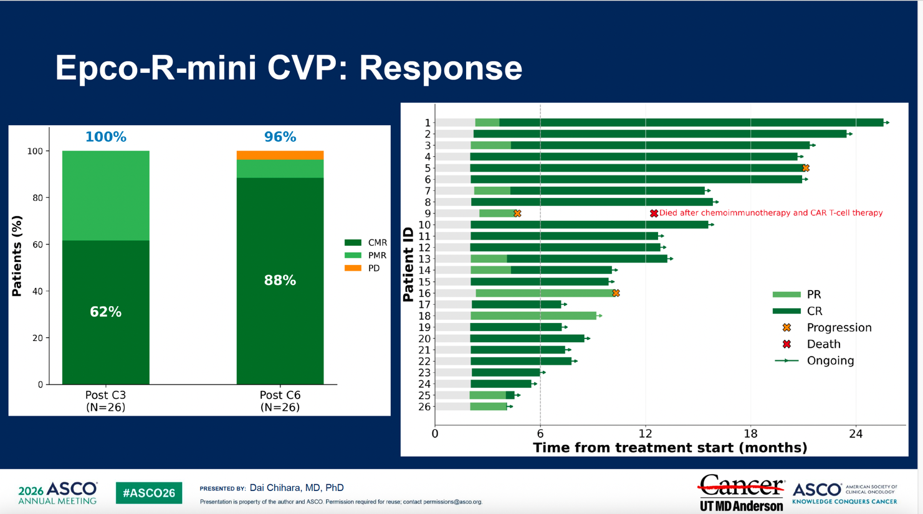

Slide 66
Select Ongoing Phase III Trials of Bispecific Antibody Combination Regimens in LBCL
Trial Identifier | Setting | Treatment Arms | Primary Endpoint
SKYGLO (NCT06047080) | Newly Diagnosed | Glofitamab + Pola-R-CHP Pola-R-CHP | PFS
EPCORE-DLBCL-2 (NCT05578976) | Newly Diagnosed | Epcoritamab + R-CHOP R-CHOP | PFS with IPI 3-5
Olympia-3 (NCT06091865) | Newly Diagnosed | Odronextamab + CHOP R-CHOP | PFS
EPCORE-DLBCL-4 (NCT06508658) | Relapsed/Refractory | Arm A: Epcoritamab (subcutaneous) + Lenalidomide Arm B: R-GemOx Arm C: Epcoritamab (subcutaneous) | PFS
www.clinicaltrials.gov (Accessed May 2026).

Slide 67
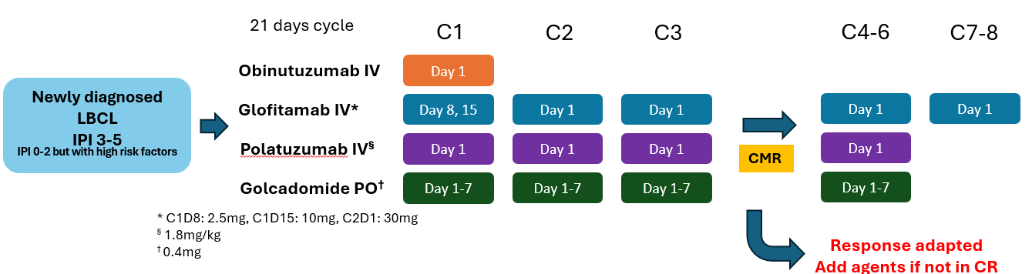
Smart 3

Slide 68
Conclusion:
Bispecific Antibody Therapy for DLBCL
Highly effective as single agents in R/R LBCL
  Glofit CRR: 40%, Epco CRR 39%
Highly effective compared with GemOx
  Glofit-GemOx improved OS
  Epco improved PFS
  Mosun-Pola improved PFS
Frontline trials are eagerly anticipated

Slide 69
Discussion Questions
58 y/o man with stage IV DLBCL, non-GCB subtype
R-CHOP as initial therapy with only partial response followed by progression within 6 months
Salvage polatuzumab vedotin/BR with transient response but rapid progression
CD19-directed CAR T-cell therapy with initial metabolic complete response on PET imaging
Recurrent adenopathy and biopsy-confirmed relapse less than 6 months later
How would you treat this patient? How are you thinking about bispecific antibody combinations for DLBCL? Are you prioritizing combinations over monotherapy for most patients?

Slide 70
Discussion Questions (Continued)
58 y/o man with stage IV DLBCL, non-GCB subtype
R-CHOP as initial therapy with only partial response followed by progression within 6 months
Salvage polatuzumab vedotin/BR with transient response but rapid progression
CD19-directed CAR T-cell therapy with initial metabolic complete response on PET imaging
Recurrent adenopathy and biopsy-confirmed relapse less than 6 months later
Would you consider allogeneic stem cell transplantation in a younger, fit patient who achieves a response after bispecific antibody therapy?
How do you approach CRS and infection-risk monitoring in heavily pretreated patients receiving sequential immune-engaging therapies?

Slide 71
Discussion Questions
81 y/o woman with stage IV DLBCL, non-GCB subtype
The patient is frail with a history of Parkinson's disease
R-mini-CHOP as initial therapy with CR but symptomatic relapse at 13 months
What treatment would you recommend?
Is there an age at which you will no longer consider CAR-T, or is the decision solely based on performance status/patient fitness?

Slide 72
Discussion Questions (Continued)
81 y/o woman with stage IV DLBCL, non-GCB subtype
The patient is frail with a history of Parkinson's disease
R-mini-CHOP as initial therapy with CR but symptomatic relapse at 13 months
For a patient in whom you are going to use bispecific antibody monotherapy, how do you choose between epcoritamab and glofitamab? Do you view them as equivalent options? Are there any advantages or disadvantages to either approach?

Slide 73
Discussion Questions
56 y/o man with DLBCL and bulky right neck LN
Primary refractory to Pola-R-CHP as initial therapy
CAR-T as second-line therapy; recurrence in the right neck 6 months later
What treatment would you offer next? Are there any promising investigational approaches in this space? Do CD19 bispecifics have any potential advantages over those directed at CD20?
If you were going to use a bispecific antibody combination, which one would you use?

Slide 74
Discussion Questions (Continued)
56 y/o man with DLBCL and bulky right neck LN
Primary refractory to Pola-R-CHP as initial therapy
CAR-T as second-line therapy; recurrence in the right neck 6 months later
For patients who receive polatuzumab as part of induction therapy, will you use it in later lines as part of a bispecific-based combination?

Slide 75
Agenda
Module 1: Chimeric Antigen Receptor (CAR) T-Cell Therapy for Diffuse Large B-Cell Lymphoma (DLBCL) — Dr Kamdar
Module 2: Bispecific Antibody Therapy for DLBCL — Dr Westin
Module 3: CAR T-Cell Therapy for Other Lymphoma Subtypes —
Dr Abramson
Module 4: Bispecific Antibody Therapy for Follicular Lymphoma and Other Lymphoma Subtypes — Dr Phillips
Module 5: Tolerability Considerations with CAR T-Cell Therapy and Bispecific Antibodies — Dr Brody

Slide 76
CAR T-cell Therapy in Other Lymphoma Subtypes (FL, MZL, MCL)
Jeremy S. Abramson, MD, MMSc
Professor of Medicine, Harvard Medical School
Director, Center for Lymphoma, Mass General Brigham Cancer Institute

Slide 77
Follicular and Marginal Zone lymphomas

Slide 78
Three CAR T-cell products for 3rd line + follicular lymphoma
 | Lisocabtagene Maraleucel TRANSCEND-FL | Tisagenlecleucel ELARA | Axicabtagene Ciloleucel ZUMA-5
n | 107 | 94 | 124
Median # prior lines | 3 | 4 | 3
Chemorefractory | 67% | 78% | 68%
POD24 | 54% | 60% | 55%
OR rate | 97% | 86% | 94%
CR rate | 94% | 69% | 79%
CRS, any grade % | 58 | 49 | 82
CRS, severe % | 1 | 0 | 7
Neurotox, any grade % | 15 | 4 | 59
Neurotox, severe % | 2 | 1 | 15
References | Morschhauser, et al. Nature Med 2024 Ahmed, et al. Proc ASH 2025 | Fowler, et al. Nat Med 2022. Schuster, et al.Proc ASH 2025 | Jacobson, et al. Lancet Onc 2022 Neelapu, et al. JCO 2025

Slide 79
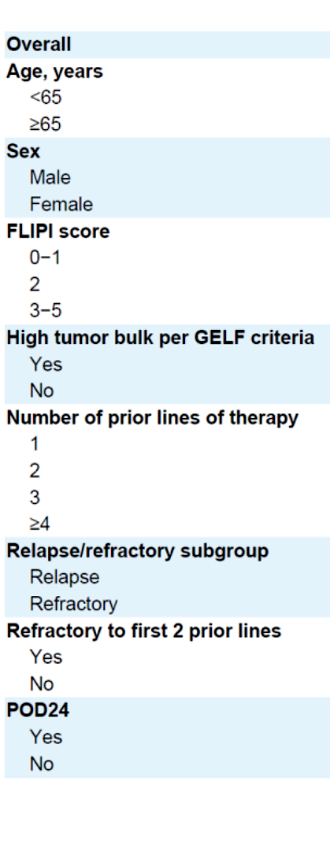
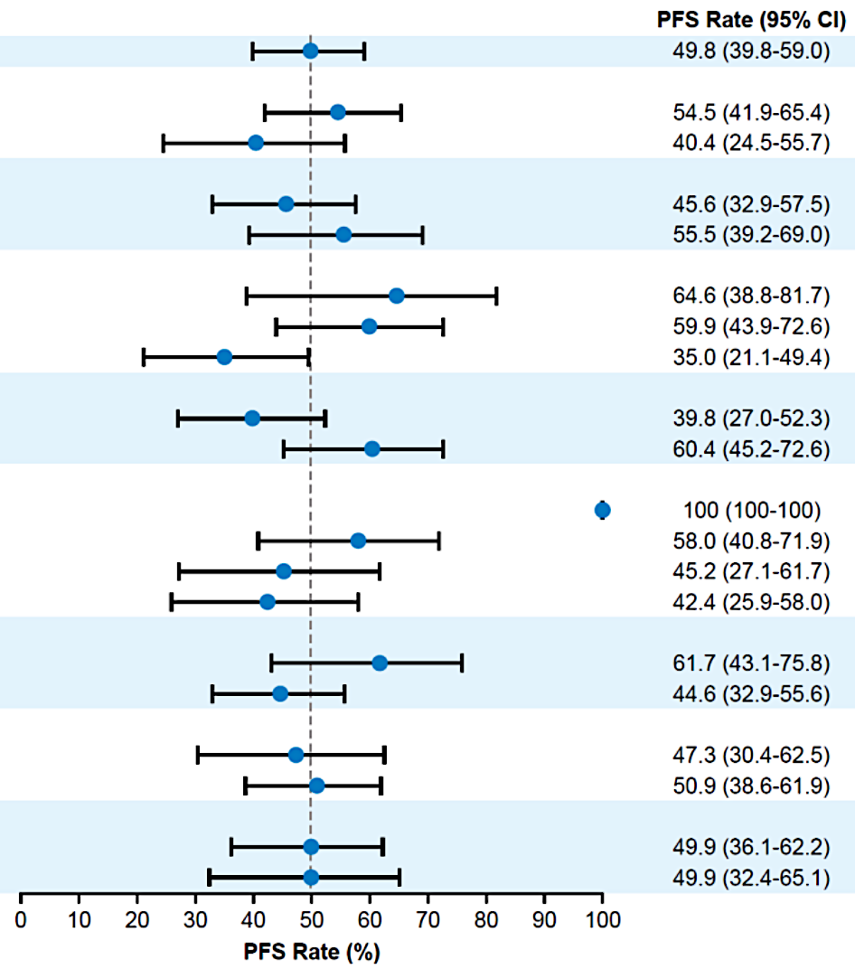
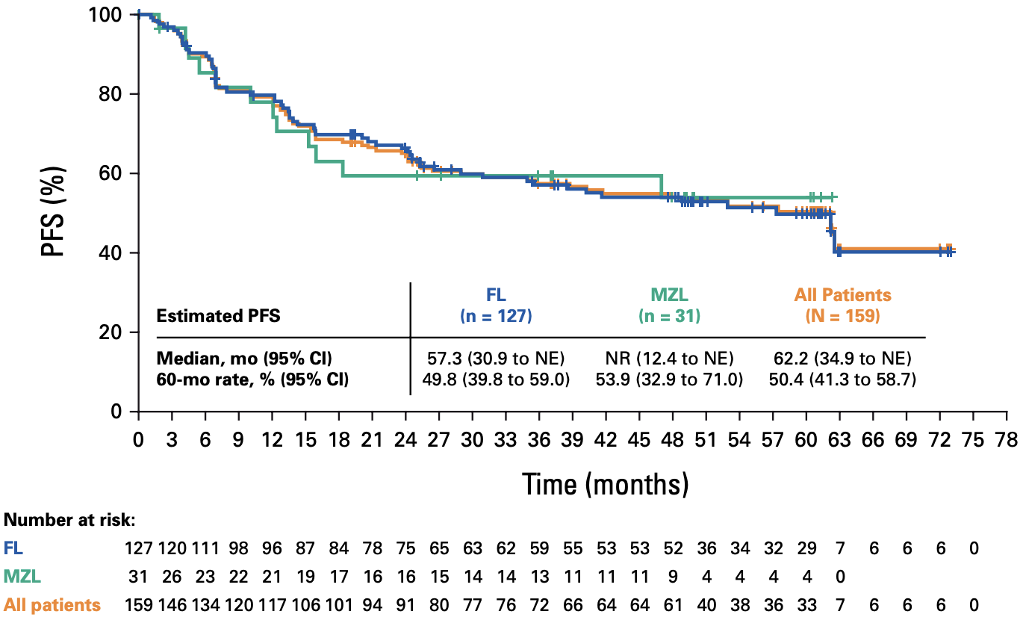
ZUMA-5: Sustained PFS at 5 years in FL and MZL
PFS | FL N=127 | MZL N=31
Median PFS | 57 m | NR
5-year PFS | 50% | 53%
 | Prior bendamustine exposure
 | None (n = 39) | ≤ 6 mo (n = 8) | 6—12 mo (n = 10) | > 12 mo (n = 70)
24-month DOR, % | 70 | 40 | 56 | 52
24-month PFS, % | 70 | 25 | 70 | 50
Neelapu, et al. JCO 2025; Neelapu, et al. Blood 2024.

Slide 80
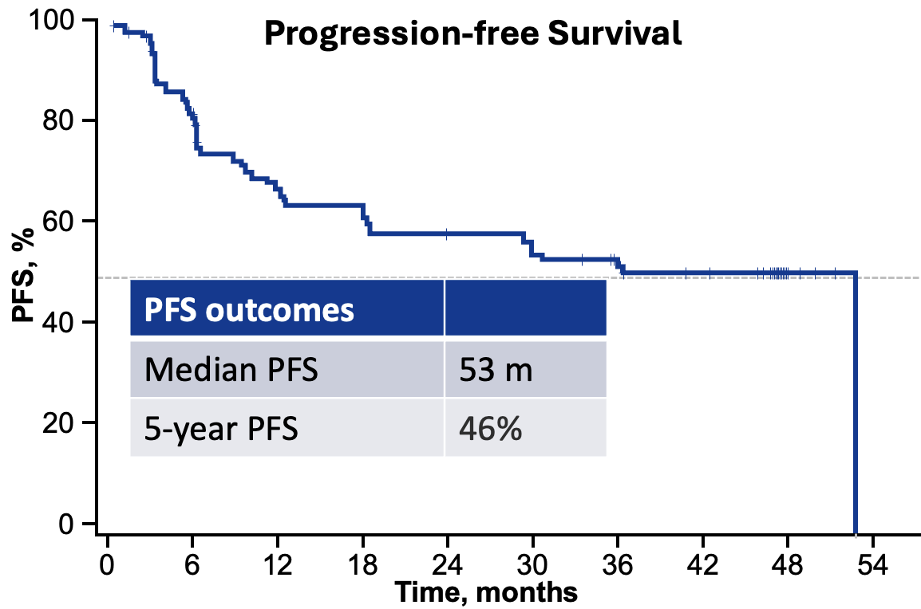
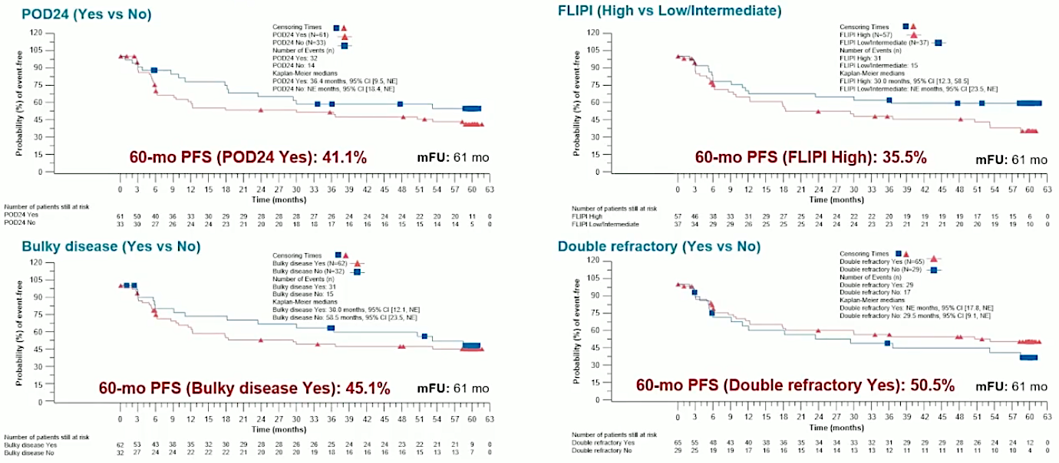
Long term follow up of Tisa-cel: 5-year results from ELARA

Slide 81
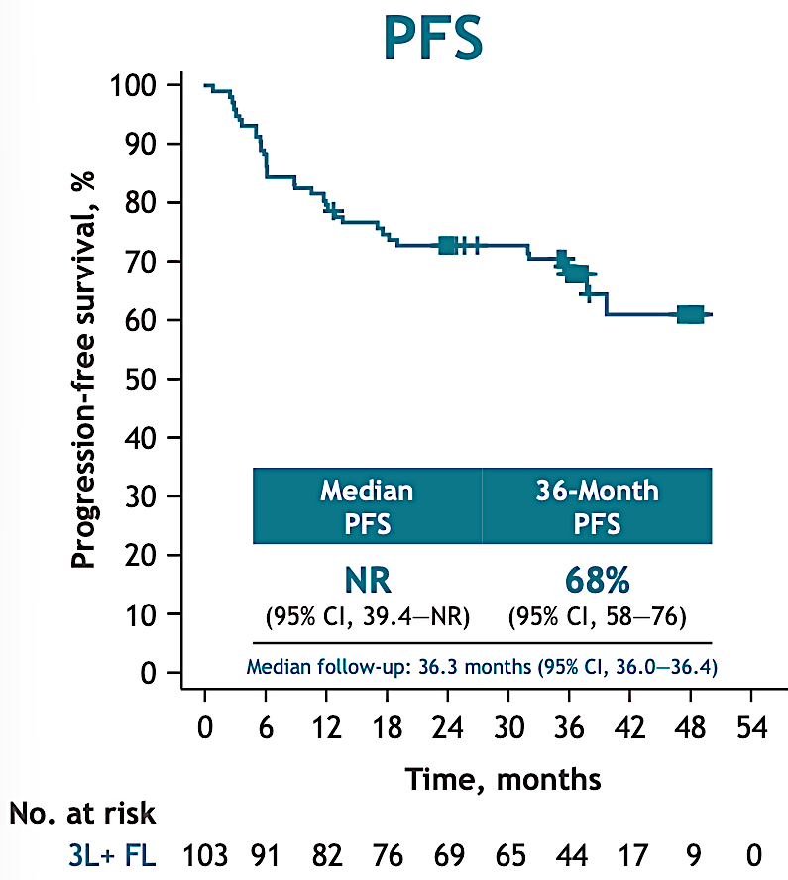
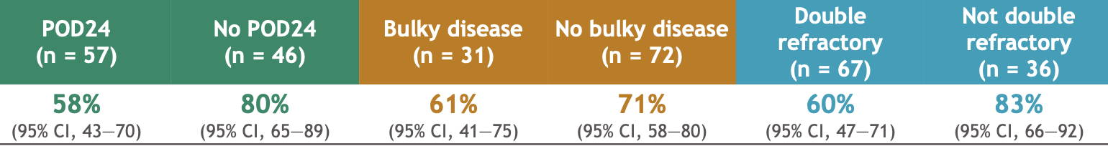

Long term follow up of TRANSCEND FL: Liso-cel at 3 years
3-year PFS in high-risk subsets
DOR based on prior bendamustine
Dreyling M, et al. EBMT 2026 [Presentation #OS02-02]

Slide 82




Sustained efficacy and safety for liso-cel in relapsed/refractory marginal zone lymphomas
ORR 95.4%
Palomba, et al. Proc ICML 2025

Slide 83
Future directions in FL: randomized trials
ZUMA-22
LEDA
Randomized phase III trial of axi-cel vs. SOC in relapsed/refractory follicular lymphoma
  Grade 1-3A FL
  1 prior line of tx and POD, or ≥2 prior lines
  SOC: investigators choice of R-CHOP, R-Benda, or R-Len
  Primary endpoint PFS
NCT05371093
Randomized phase III trial of tisa-cel vs. SOC in relapsed/refractory follicular lymphoma
  Grade 1-3A FL
  ≥2 prior lines of tx
  SOC: investigators choice of R-CHOP or R-Len
  Primary endpoint PFS
NCT05888493

Slide 84
Mantle cell lymphoma

Slide 85

Brexu-cel for 3L+ MCL post cBTK inhibition: ZUMA-2
Baseline Characteristics
n | 68
Median # prior lines | 3 (1-5)
BTKI refractory | 62%
TP53 mut | 17%
Blastoid | 31%
KI67 ≥ 30% | 82%
Progression-free survival
Median 25.3 m
Endpoint | n=68
ORR | 93%
CRR | 67%
Median DOR | 36.5 m
Median DOCR | 46.7 m
Toxicity
Any-grade CRS | 91%
Grade ≥ 3 CRS | 15%
Any-grade ICANS | 63%
Grade ≥ 3 ICANS | 31%
Wang, et al. NEJM 2020; Wang, et al. Proc ASH 2024; Munoz, et al. J Hematology & Oncology 2026

Slide 86


Real world evidence for Brexu-cel in MCL from CIBMTR
Characteristics | n = 476
Median age | 67 (34-85)
TP53 mutated | 19%
KI67 ≥ 30% | 68%
Median no. of prior treatments | 4 (1-12)
Prior BTKi | 88%
Prior ASCT | 30%
Endpoint
ORR | 91%
CRR | 82%
12m DOR | 79%
Toxicity
Any-grade CRS | 89%
Grade ≥ 3 CRS | 11%
Any-grade ICANS | 62%
Grade ≥ 3 ICANS | 30%
12m NRM | 8%
Ahmed, at al. Blood Adv 2024

Slide 87

Real world evidence for Brexu-cel in MCL from DESCAR-T
Characteristics | n = 152 (of 178)
Median age | 69 (39-83)
TP53 mutated | 30%
KI67 ≥ 30% | 79%
Median no. of prior treatments | 3 (1-9)
Prior BTKi | 100%
Prior ASCT | 40%
Median PFS: 9.5 months
Toxicity
Any-grade CRS | 88%
Grade ≥ 3 CRS | 12%
Any-grade ICANS | 55%
Grade ≥ 3 ICANS | 15%
ICU | 34%
NRM | 11%
Endpoint
ORR | 85%
CRR | 72%
Herbaux, at al. Haematologica 2024

Slide 88

Liso-cel for 3L+ MCL post cBTK inhibition: TRANSCEND
Baseline Characteristics
n | 88
Median # prior lines | 3 (1-11)
BTKI refractory | 53%
TP53 mut | 23%
Blastoid | 31%
Endpoint | n=83
ORR | 83%
CRR | 72%
Median DOR | 14.5 m
Median DOCR | 15.7 m
Toxicity
Any-grade CRS | 61%
Grade ≥ 3 CRS | 1%
Any-grade ICANS | 31%
Grade ≥ 3 ICANS | 9%
ICU | 6%
Wang, et al. JCO 2023.; Wang M, et al. ASTCT 2025. Abstract 240.
Notes:
Wang M, et al. ASTCT 2025. Poster 240. E,G
Wang M, et al. ASTCT 2025. Poster 240. E

Slide 89
Discussion Questions
68 y/o man with Stage IV FL, grade 2, FLIPI 4 with widespread LAN and bone marrow involvement without B symptoms, ECOG 1
PMH: HTN, type 2 diabetes, AMI with preserved EF
BR as initial therapy with partial response; progression at 18 months
R² with CR; progression 14 months later with axillary and inguinal LAN and cytopenias
Obinutuzumab + chemo with PR; progression after 9 months
In FL, are you typically using CAR-T or bispecific antibodies first? What would you recommend for this patient?
Given this patient has already received R², is there any role for bispecific combinations?

Slide 90
Discussion Questions
59 y/o man with FL
R-CHOP followed by R maintenance as initial therapy
Epcoritamab + R² as second-line therapy; currently in remission
At disease progression, what would you offer as third-line therapy? Would the length of remission influence your decision-making in any way?

Slide 91
Discussion Questions
70 y/o man, a retired physician, with extensive, symptomatic MCL
BR as initial therapy with response; progression within 2 years
Ibrutinib with response but now with extensive, symptomatic GI and nodal progression
What therapy would you use next? If CAR-T, would you have a preference for one platform versus the others?
For patients with MCL going to CAR-T, what bridging therapy, if any, do you typically employ?
How, if at all, does the recent approval of sonrotoclax impact your sequencing of therapy for MCL?
Is there any role for bispecifics in MCL at the current time?

Slide 92
Agenda
Module 1: Chimeric Antigen Receptor (CAR) T-Cell Therapy for Diffuse Large B-Cell Lymphoma (DLBCL) — Dr Kamdar
Module 2: Bispecific Antibody Therapy for DLBCL — Dr Westin
Module 3: CAR T-Cell Therapy for Other Lymphoma Subtypes —
Dr Abramson
Module 4: Bispecific Antibody Therapy for Follicular Lymphoma and Other Lymphoma Subtypes — Dr Phillips
Module 5: Tolerability Considerations with CAR T-Cell Therapy and Bispecific Antibodies — Dr Brody

Slide 93
Evolving Role of Bispecific Antibodies in Low and Intermediate Grade Lymphoma
Tycel Phillips, MD
Associate Professor
City of Hope

Slide 94

Follicular Lymphoma
R/R FL has undergone an evolution in the last several years with the approval of several novel agents
  CAR-T
    Approval of three agents in this space similar to DLBCL
  Small Molecules
    Zanubrutinib
      Rosewood-Obinutuzumab -> pivotal study in process (MAHOGANY)
    Tazemetostat
      RIP

Slide 95
Bispecific Antibodies

Slide 96
Mosunetuzumab
Budde LE et al. Lancet Oncol 2022;23(8):1055-1065.
SQ dosing 5 mg (C1D1), 45 mg (C1D8), 45 mg C1D15 until EOT

Slide 97



Mosunetuzumab Response (FL)
Budde LE et al. Lancet Oncol. 2022;23(8):1055-1065

Slide 98


Mosunetuzumab Safety (FL)
Budde LE et al. Lancet Oncol. 2022;23(8):1055-1065

Slide 99

Epcoritamab
Trial

Slide 100

Epcoritamab Response (R/R FL)

Slide 101

Epcoritamab Safety (R/R FL)
Linton et al. ASH 2023

Slide 102


2L FL: AUGMENT

Slide 103

EPCORE FL-1

Slide 104


EPCORE FL-1: Response
Epcoritamab+R²
Falchi et al. ASH 2025. Abstract 466

Slide 105


EPCORE FL-1: Safety
Manageable
Falchi et al. ASH 2025. Abstract 466

Slide 106

CELESTIMO Trial of Mosunetuzumab-Lenalidomide versus R² in R/R FL

Slide 107



CELESTIMO US Cohort: Baseline Characteristics

Slide 108


CELESTIMO US Cohort: Safety/Response

Slide 109
Ongoing Studies
Phase | Line | Drug | Comparator | Study | Primary Endpoint | Global | Sites
3 | 2L | Mosunetuzumab + lenalidomide | CIT | MorningLyte | PFS | N | France Germany Portugal Spain
3 | 1L | Mosunetuzumab | Rituximab | S2308 | PFS | N | USA
3 | 1L | Odronextamab | CIT | OLYMPIA-1 | CR30 | Y
3 | 2L | Odronextamab + R² | R² | OLYMPIA-5* | PFS | Y
3 | 1L | Epcoritamab + R² | CIT | EPCORE – FL -2 | CR30 PFS | Y
3 | 2L | Mosunetuzumab + lenalidomide | CIT or R² | MARSUN | PFS | N | France Germany Portugal Belgium Italy
*includes MZL

Slide 110

R/R MCL – Glofitamab updated data after a 3.5-year follow-up
Remains a difficult space despite approval of
  CAR-T (long term follow up w/ very few patients still in remission (cure unlikely).
  Pirtobrutinb (likely best served as a bridge for most patients).
  Sonrotoclax (response rates similar to pirto)
As such other options are still needed.
  Mosun/Pola – Impressive early response, and safety but lacks long term data to support durability

Slide 111
Duration of complete response
DOCR*†
DOCR COVID-19 sensitivity*
100
36-month DOCR rate (95% CI):
59.1% (38.5, 79.8)
50.5% (35.5, 65.4)
42.7% (22.0, 63.3)
100
36-month DOCR rate (95% CI):
63.4% (43.0, 83.8)
58.3% (42.7, 73.9)
53.7% (30.7, 76.6)
80
80
60
60
DOCR probability (%)
DOCR probability (%)
40
Prior BTKi (n=24)
40
Prior BTKi (n=24)
20
BTKi naïve (n=23)
20
BTKi naïve (n=23)
All patients (n=47)
All patients (n=47)
0
Censored
0
Censored
0
3
6
9
12
15
18
21
24
27
30
33
36
39
42
45
48
51
54
0
3
6
9
12
15
18
21
24
27
30
33
36
39
42
45
48
51
54
No. of patients at risk
Time (months)
No. of patients at risk
Time (months)
Prior BTKi
24
21
17
15
14
12
11
11
11
11
11
8
6
6
3
1
1
1
NE
Prior BTKi
24
21
17
15
14
12
11
11
11
11
11
8
6
6
3
1
1
1
NE
BTKi naïve
23
21
21
19
19
15
14
13
12
12
10
7
4
4
3
2
1
NE
BTKi naïve
23
21
21
19
19
15
14
13
12
12
10
7
4
4
3
2
1
NE
All patients
47
42
38
34
33
27
25
24
23
23
21
15
10
10
6
3
2
1
NE
All patients
47
42
38
34
33
27
25
24
23
23
21
15
10
10
6
3
2
1
NE
DOCR | Prior BTKi (n=24) | BTKi naive (n=23) | All patients (n=47)
Median DOCR, months (95% CI) | 15.4 (8.3, NE) | 46.5 (14.1, NE) | 40.8 (14.1, NE)
DOCR | Prior BTKi (n=24) | BTKi naive (n=23) | All patients (n=47)
Median DOCR, months (95% CI) | 40.8 (14.4, NE) | 46.5 (14.1, NE) | 46.5 (23.1, NE)
Fixed-duration glofitamab monotherapy achieved durable CRs in patients with prior BTKi
and those who were BTKi naïve; COVID-19 censoring further extended the median DOCR
*INV-assessed. †Median DOCR follow-up was 34.6 months (range: 1–54) overall, and 40.3 months (range: 1–54) and 33.4 months (range: 2–49) in the prior-BTKi and BTKi-naïve cohorts, respectively.
CI, confidence interval; NE, not estimable.
Karimi et al. ASCO 2026

Slide 112
Progression-free survival
PFS*†
PFS COVID-19 sensitivity*
100
36-month PFS rate (95% CI):
49.7% (30.2, 69.1)
39.4% (26.6, 52.2)
31.0% (14.7, 47.4)
100
36-month PFS rate (95% CI):
52.6% (32.8, 72.3)
45.1% (31.5, 58.7)
38.9% (20.3, 57.5)
80
80
60
60
PFS probability (%)
PFS probability (%)
40
Prior BTKi (n=34)
40
Prior BTKi (n=34)
20
BTKi naïve (n=27)
20
BTKi naïve (n=27)
All patients (N=61)
All patients (N=61)
0
Censored
0
Censored
0
3
6
9
12
15
18
21
24
27
30
33
36
39
42
45
48
51
54
57
0
3
6
9
12
15
18
21
24
27
30
33
36
39
42
45
48
51
54
57
No. of patients at risk
Time (months)
No. of patients at risk
Time (months)
Prior BTKi
34
25
19
16
14
14
12
11
11
11
11
8
7
7
6
3
1
1
1
NE
Prior BTKi
34
25
19
16
14
14
12
11
11
11
11
8
7
7
6
3
1
1
1
NE
BTKi naïve
27
26
23
20
20
20
17
15
13
13
11
9
5
4
4
2
2
NE
BTKi naïve
27
26
23
20
20
20
17
15
13
13
11
9
5
4
4
2
2
NE
All patients
61
51
42
36
34
34
29
26
24
24
22
17
12
11
10
5
3
1
1
NE
All patients
61
51
42
36
34
34
29
26
24
24
22
17
12
11
10
5
3
1
1
NE
PFS | Prior BTKi (n=34) | BTKi naive (n=27) | All patients (N=61)
Median PFS, months (95% CI) | 11.3 (5.1, 32.6) | 28.5 (17.0, NE) | 18.0 (11.3, 42.8)
PFS | Prior BTKi (n=34) | BTKi naive (n=27) | All patients (N=61)
Median PFS, months (95% CI) | 16.8 (5.2, NE) | 50.0 (19.6, NE) | 23.5 (15.6, NE)
Clinically meaningful PFS was achieved with glofitamab monotherapy after 3.5 years of follow-up;
COVID-19 censoring further extended the median PFS from 18.0 to 23.5 months
*INV-assessed. †Median PFS follow-up was 36.0 months (range: 0–55) overall,
and 43.7 months (range: 0–55) and 35.9 months (range: 2–51) in the prior-BTKi and BTKi-naïve cohorts, respectively.
Karimi et al. ASCO 2026

Slide 113
Overall survival
OS*
100
36-month OS rate (95% CI):
72.7% (54.1, 91.3)
54.0% (41.2, 66.9)
40.6% (23.4, 57.8)
80
OS | Prior BTKi (n=34) | BTKi naive (n=27) | All patients (N=61)
Median OS, months (95% CI) | 29.9 (11.3, NE) | NE (NE, NE) | NE (26.9, NE)
60
OS probability (%)
40
20
Prior BTKi (n=34)
BTKi naïve (n=27)
All patients (N=61)
0
Censored
0
3
6
9
12
15
18
21
24
27
30
33
36
39
42
45
48
51
54
57
60
63
66
No. of patients at risk
Time (months)
Prior BTKi
34
28
25
21
20
19
17
17
16
16
15
12
11
9
8
7
5
3
1
NE
BTKi naïve
27
27
26
24
24
24
22
22
21
20
18
17
15
8
8
8
8
2
1
1
1
1
NE
All patients
61
55
51
45
44
43
39
39
37
36
33
29
26
17
16
15
13
5
2
1
1
1
NE
Durable OS was achieved with fixed-duration glofitamab monotherapy
in patients with prior BTKi and those who were BTKi naïve
*Median OS follow-up was 41.5 months (range: 0–65) overall, and 45.4 months (range: 0–55) and 38.4 months (range: 5–65) in the prior-BTKi and BTKi-naïve cohorts, respectively;
at the time of analysis, 22 patients had died, the majority due to progressive disease (n=7) or COVID-19 (n=7).
All patients who died due to COVID-19 had achieved a CR, and six remained in remission at the time of death.
Karimi et al. ASCO 2026

Slide 114

Landmark analyses by response at EOT
PFS* post EOT
OS post EOT
100
100
24-month rate in patients with CR* at EOT: 77.3% (95% CI: 62.5, 92.1)
80
24-month rate in patients with CR* at EOT: 65.6% (95% CI: 48.1, 83.0)
80
60
60
PFS probability (%)
OS probability (%)
40
40
CR (n=31)
CR (n=31)
PR (n=2)
20
PR (n=2)
20
NR (n=11)
NR (n=11)
Censored
Censored
0
0
0
3
6
9
12
15
18
21
24
27
30
33
36
39
42
45
48
0
3
6
9
12
15
18
21
24
27
30
33
36
39
42
45
48
51
54
57
60
No. of patients at risk
Months (post EOT)
No. of patients at risk
Months (post EOT)
CR
31
28
26
25
21
21
21
19
16
11
10
8
4
3
3
1
NE
CR
31
30
29
27
26
26
25
23
22
19
12
11
10
7
5
2
1
1
1
1
NE
PR
2
2
2
2
2
1
1
1
NE
NE
NE
NE
NE
NE
NE
NE
NE
PR
2
2
2
2
2
2
2
2
1
1
1
1
1
1
NE
NE
NE
NE
NE
NE
NE
NR
11
NE
NE
NE
NE
NE
NE
NE
NE
NE
NE
NE
NE
NE
NE
NE
NE
NR
11
7
7
6
6
6
6
5
5
5
4
4
4
3
2
2
NE
NE
NE
NE
NE
Landmark PFS from EOT in patients with CR* at EOT | All patients N=61
Median PFS, months (95% CI) | 44.1 (23.6, NE)
Landmark OS from EOT in patients with CR* at EOT | All patients N=61
Median OS, months (95% CI) | NE (NE, NE)
A large proportion of patients (65.6%) with a CR at EOT
remained progression-free and alive 2 years post EOT
*INV-assessed.
EOT, end of treatment; NR, no response.
Karimi et al. ASCO 2026

Slide 115
B-cell depletion and recovery
600
ULN: 500 cells/µL
400
CD19+ B–cells (cells/µl)
200
LLN: 70 cells/µL
0
C1D1
n=29
C1D8
n=30
0–6mo
n=18
6–12mo
n=19
12–18mo
n=18
18–24mo
n=16
24–30mo
n=14
30–36mo
n=10
36–42mo
n=4
42–48mo
n=1
Gpt
2.5mg
glofitamab
Post treatment
Peripheral B-cell depletion was rapid and sustained after treatment initiation.
Recovery above the lower limit of normal was observed 12–18 months post EOT
Patients who completed 12 cycles of treatment and did not have progressive metabolic disease at EOT were included in this analysis. Samples occurring within 45 days of a progression event were excluded. Only serious infections were systematically collected beyond the 90-day AE reporting period.
LLN, lower limit of normal; mo, months; ULN, upper limit of normal.
Karimi et al. ASCO 2026

Slide 116

Surovatamig Phase I Study: FL Cohort
Hou et al. ASH 2025; Abstract 1005.

Slide 117

Surovatamig Phase I Study: Response Rates in FL Cohort
Responses were noted in various patient subgroups examined, including those with prior exposure to CD19 CAR T and CD20 T-cell engagers
95% of MRD-evaluable patients with CR achieved undetectable MRD
Hou et al. ASH 2025; Abstract 1005.

Slide 118


Phase III SOUNDTRACK-F1 study
Global, Randomized, Phase 3, Multicenter, Open-label Study of
Surovatamig Plus Rituximab in Patients With Previously Untreated High Tumor Burden FL
Cheah et al ASH 2025

Slide 119
Conclusion
Bispecific antibodies w/ excellent response rate and safety as single agents in FL.
Combination w/ lenalidomide has helped to improve DOR, ORR, PFS, and TTNT.
  Impressive data in 2L FL and pending studies in 1L setting vs. rituximab (asymptomatic patients) and CIT (symptomatic by GELF).
Additional options need in R/R MCL.
  Time limited glofitamab w/ durable responses in patients who obtain a complete response
    Especially notable in those who maintain a CR at EOT.
    Improvement in rates/severity of CRS is needed.

Slide 120
Discussion Questions
60 y/o man with FL
BR as initial therapy; progression 6 month into R maintenance
Switched to temporizing R²
Rebiopsy shows no transformation to DLBCL
Would you add epcoritamab to R² at the current time? In general, how are you using that regimen in your practice? Are you prioritizing it over R² alone and tafasitamab/R² for most patients with FL?

Slide 121
Discussion Questions
80 y/o woman with FL
BR as initial therapy; progression
Tafasitamab/R² as second-line therapy; ECOG 2 and frail
What is the optimal third-line therapy for R/R FL in elderly, frail patients, given the withdrawal of tazemetostat? Is a bispecific a reasonable consideration? If so, would you have a preference for mosunetuzumab or epcoritamab?

Slide 122
Discussion Questions
78 y/o woman with FL and excellent performance status
Past treatments include weekly rituximab, BR and R²
Would you offer either tafasitamab/R² or epcoritamab/R² to this patient?
If so, what is the minimum interval for these treatments after prior exposure to R²?

Slide 123
Agenda
Module 1: Chimeric Antigen Receptor (CAR) T-Cell Therapy for Diffuse Large B-Cell Lymphoma (DLBCL) — Dr Kamdar
Module 2: Bispecific Antibody Therapy for DLBCL — Dr Westin
Module 3: CAR T-Cell Therapy for Other Lymphoma Subtypes —
Dr Abramson
Module 4: Bispecific Antibody Therapy for Follicular Lymphoma and Other Lymphoma Subtypes — Dr Phillips
Module 5: Tolerability Considerations with CAR T-Cell Therapy and Bispecific Antibodies — Dr Brody

Slide 124


Tolerability Considerations with CAR T-Cell Therapy and Bispecific Antibodies
Tolerability Considerations with CAR T-Cell Therapy and Bispecific Antibodies
Joshua Brody MD
Professor of Hematology and Medical Oncology
Director, Lymphoma Immunotherapy Program
Mount Sinai School of Medicine, New York, NY
Notes:
· Comparative frequency and severity of (CRS) and (ICANS) with available anti-CD19 CAR T-cell constructs in various NHL subtypes
· Guideline-endorsed approaches for mitigation, monitoring and management of CRS and ICANS; role of corticosteroids, tocilizumab and other supportive care interventions
· Rationale for and implications of the recent elimination of the (REMS) for patients receiving CAR T
· Long-term tolerability/toxicity considerations (eg, delayed neurotoxicity, cytopenias, hypogammaglobulinemia, infection, secondary malignancy) with CAR T
· Incidence, severity and time course of CRS and ICANS with bispecific antibody therapy in NHL
· Other tolerability concerns with bispecific antibodies in patients with NHL; recommended mitigation and management protocols

Slide 125
Comparative CRS and ICANS with αCD19 CAR-T in NHL
subtype | construct | trial | pub year | N | CRS any | CRS ≥3 | ICANS any | ICANS ≥3
LBCL | axi-cel | ZUMA-1 | 2017 | 111 | 93% | 13% | 64% | 28%
LBCL | tisa-cel | JULIET | 2019 | 93 | 58% | 22% | 21% | 12%
LBCL | liso-cel | TRANSCEND | 2020 | 256 | 42% | 2% | 30% | 10%
MCL | brexu-cel | ZUMA-2 | 2020 | 60 | 91% | 15% | 63% | 31%
FL | axi-cel | ZUMA-5 | 2021 | 104 | 82% | 7% | 59% | 19%
LBCL (2L) | axi-cel | ZUMA-7 | 2022 | 180 | 92% | 6% | 60% | 21%
LBCL (2L) | tisa-cel | BELINDA | 2022 | 162 | 61% | 5% | 10% | 2%
LBCL (2L) | liso-cel | TRANSFORM | 2022 | 92 | 49% | 1% | 11% | 4%
FL | tisa-cel | ELARA | 2022 | 97 | 49% | 0% | 37% | 3%
Locke FL et al. Lancet Oncol, 2019; Schuster SJ et al. New Engl J Med, 2019; Abramson JS et al. Lancet, 2020; Wang M et al. New Engl J Med, 2020; Jacobson CA et al. Lancet Oncol, 2022; Locke FL et al. New Engl J Med, 2022; Bishop MR et al. Lancet Oncol, 2023; Kamdar M et al. Lancet, 2022; Fowler NH et al. Nat Med, 2022

Slide 126


Guidelines for mitigation, monitoring, management of CRS and ICANS
Crombie JL et al., Consensus recommendations on… Blood 2024

Slide 127
Rationale for and implications: 7/2025 elimination of CAR-T REMS
FDA: “accumulated physician experience, improved toxicity-recognition algorithms, standardized management pathways for CRS and ICANS, and extensive safety data now make formal REMS programs unnecessary”
Rationale:
Clinical familiarity and standardization
- extensive experience managing CRS and ICANS
- consensus grading systems, standardized steroid/toci algorithms, and earlier intervention reduced high-grade AEs
2. Real-world evidence demonstrating manageable risk
- 100s of centers and 10,000s of patients => large post-marketing datasets showing that toxicities are predictable and treatable. - boxed warnings and product labeling alone are now sufficient to communicate these risks.
Implications:
1. Access barriers created by REMS
-REMS significantly constrained geographic availability of CAR-T
-for small hospitals: certification, staffing requirements, reporting obligations, and pharmacy prep were resource-intensive
2. Operational inefficiency and delays
-CAR-T patients may have rapidly progressive dx =>
-administrative delays with REMS certification and transfer to specialized centers prevents timely treatment.
-eliminating REMS is expected to shorten referral-to-infusion timelines, box warnings remain in place
3. Updated label requirements
-Duration to stay near site reduced to 2 weeks
-Driving restrictions reduced to 2 weeks
-Boxed warnings remain
Notes:
Risk Evaluation and Mitigation Strategy
-implication is that toxicity-management responsibility may shift more heavily from regulatory structures to professional societies and institutional standards. In practice, major centers are unlikely to abandon stringent monitoring protocols simply because REMS disappeared. Instead, best practices will increasingly be governed by ASTCT, NCCN, EBMT, and institutional SOPs rather than FDA-mandated certification.
Products with intrinsically lower CRS/ICANS profiles may gain commercial advantages because community deployment becomes more feasible without specialized REMS infrastructure.

Slide 128



CAR T-Cells: Late toxicities - cytopenias
Rejeski K et al., Blood. 2021
www.german-lymphoma-alliance.de/Scores.html

Slide 129




HR 2.6 p<0.001
CAR T-Cells: Late toxicities - infections
*HT, CAR-HEMATOTOX score
CD19 CART BCMA CART
%infection
%>G3 infection
survival
%NRM
Rejeski K et al., J Immunother Cancer. 2022
Kampouri E et al., Transpl Infect Dis. 2023

Slide 130



P = 0.02
CAR T-Cells: Late toxicities - infections
Cordas Dos Santos, DM et al., Nat Med 2024

Slide 131

Long-term tolerability/toxicity: secondary malignancy
Aleman A, Van Oekelen O, …, Brody JD, Parekh S.N Engl J Med. 2025 Aug 21;393(8):823-825

Slide 132

Incidence, severity, timing of CRS and ICANS with bispecifics in B-NHL
Hutchings et al., JCO 2021, Thieblemont et al., JCO 2023, Budde et al., JCO 2022, Min Kim et al., (Suppl) Blood 2025

Slide 133
Fewer Infections with Lymphoma vs Myeloma Bispecifics
Agent |  | Grade ≥ 3 Infections | Grade 5 Infections | Grade ≥ 3 CRS | Grade ≥ 3 Neutropenia
Multiple Myeloma | BCMA target^{[1]} Linvoseltamab Elranatamab Teclistamab | 29% 32% 45% | 4% 5% 12% | 1% 0 1% | 23% 48% 64%
Multiple Myeloma | Non-BCMA target^{[1]} (talquetamab) | 18% | 0 | 3% | 37%
Lymphoma | Mosunetuzumab^{[2]} | 14% | – | 1% | 27%
Lymphoma | Epcoritamab^{[3]} | 14% | – | 2.5% | 14.6%
1. Gemma Reynolds, et al. Blood Adv. 2023;7:5898-5903; 2. Budde LE, et al. Lancet Oncol. 2022;23:1055-1065; 3. Thieblemont, et al. J Clin Oncol. 2023 20;41:2238-2247.

Slide 134

Lymphoma Immunotherapy 2026: miraculous advances since 2000

Slide 135
Discussion Questions
71 y/o woman with FL with bulky symptomatic nodal disease
PMH: COPD, recurrent respiratory infections
Past treatments include weekly BR and R²
Currently receiving a bispecific antibody with good clinical response
What are the current best practices regarding infection prophylaxis, IVIG replacement and long-term monitoring for patients receiving bispecifics for FL?
For patients with NHL receiving bispecific antibodies, are you recommending prophylactic tocilizumab as is commonly done in multiple myeloma?

Slide 136
Discussion Questions
72 y/o man with blastoid variant MCL with TP53 mutation
R-CHOP/acalabrutinib as initial therapy with almost no response
Treated with emergent fractionated cyclophosphamide/rituximab/
radiotherapy followed by CAR-T; dramatic CR on PET
Patient had grade 2 CRS and grade 1 ICANS
Is there more CRS and/or ICANS with CAR-T in MCL versus DLBCL or FL?
If so, why?
How should we be monitoring patients with ongoing responses to CAR-T? Is there a time point after which toxicities are highly unlikely to occur?
Would the experts recommend any type of maintenance therapy post CAR-T, and if so what?

Slide 137
Discussion Questions
50 y/o woman with stage 4, grade 2 FL diagnosed in 2012
BR as initial treatment; disease progression at 2 years
R-CHOP followed by 2 years of R maintenance as second-line therapy; long-term remission with symptomatic progression in 2023
Mosunetuzumab as third-line therapy
Recurrent admissions for hematuria; cystoscopy shows hemorrhagic cystitis
Is hemorrhagic cystitis associated with mosunetuzumab?
Are there any uncommon toxicities with bispecific antibodies that community-based clinicians should know about?

Slide 138
What Clinicians Want to Know: Addressing Community
Oncologists’ Questions About the Current and Future Role of
Antibody-Drug Conjugates in the Management of Breast Cancer
A CME Symposium Held Adjunct with the 2026 ASCO® Annual Meeting
Monday, June 1, 2026
7:00 PM – 9:00 PM CT (8:00 PM – 10:00 PM ET)
Faculty
Professor Giuseppe Curigliano, MD, PhD
Rebecca A Dent, MD, MSc
Erika Hamilton, MD
Nadia Harbeck, MD, PhD
Moderator
Hope S Rugo, MD

Slide 139
Second Opinion: Investigators Provide Perspectives on the Current and Future Use of Novel Therapies for Non-Hodgkin Lymphoma
A CME Symposium Held Adjunct with the 2026 ASCO® Annual Meeting
Monday, June 1, 2026
7:00 PM – 9:00 PM CT (8:00 PM – 10:00 PM ET)
Faculty
Christopher Flowers, MD, MS, FASCO
Matthew Lunning, DO
Sonali M Smith, MD
Moderator
Brad S Kahl, MD

Slide 140
Consensus or Controversy? Documenting and Discussing Investigators’ Approaches to the
Management of Relapsed/Refractory Multiple Myeloma
A CME Symposium Held Adjunct with the 2026 ASCO® Annual Meeting
Monday, June 1, 2026
7:00 PM – 9:00 PM CT (8:00 PM – 10:00 PM ET)
Faculty
Melissa Alsina, MD
Hans Lee, MD
Paul G Richardson, MD
Moderator
Sagar Lonial, MD, FACP, FASCO

Slide 141
Thank you for joining us!
Your feedback is very important to us.
Please complete the survey currently up on the iPads for attendees in the room and on Zoom for those attending virtually. The survey will remain open up to 5 minutes after the meeting ends.
How to Obtain CME Credit
In-person attendees: Please refer to the program syllabus for the CME credit link or QR code. Online/Zoom attendees:
The CME credit link is posted in the chat room.

