Slide 1
Integrating New Advances into
Community Oncology Practice
A Multitumor Symposium Hosted in Conjunction with the American Oncology Network
CME/MOC, NCPD and ACPE Accredited
Saturday, August 22, 2026
9:00 AM – 2:20 PM CT

Slide 2
Agenda
Module 1 — Chronic Lymphocytic Leukemia
Farrukh T Awan, MD, MS, MBA
Module 2 — Gastroesophageal Cancers
Samuel J Klempner, MD
Module 3 — Ovarian and Endometrial Cancer
Shannon N Westin, MD, MPH, FASCO, FACOG
Module 4 — Diffuse Large B-Cell Lymphoma
Ann LaCasce, MD, MMSc
Module 5 — Lung Cancer
Stephen V Liu, MD

Slide 3


Diffuse Large B-Cell Lymphoma Faculty
Ann LaCasce, MD, MMSc
Associate Professor, Hematology and Medical Oncology
Program Director, Dana-Farber/MGB Fellowship in Hematology/Oncology
Dana-Farber Cancer Institute
Harvard Medical School
Boston, Massachusetts
MODERATOR
Stephen “Fred” Divers, MD
Chief Medical Officer
American Oncology Network
Board Executive
Community Oncology Alliance
Hot Springs, Arkansas

Slide 4
Dr LaCasce — Disclosures
Advisory Committees | Caribou Biosciences Inc, Genmab US Inc, Kite, A Gilead Company
Consulting Agreements | Genmab US Inc, Pierre Fabre, Takeda Pharmaceuticals USA Inc

Slide 5
Dr Divers — Disclosures
Advisory Committees | Daiichi Sankyo Inc

Slide 6
Snapshot of AON Practice
DLBCL

Slide 7
Snapshot of AON Practice
DLBCL — Polatuzumab vedotin

Slide 8
Snapshot of AON Practice
DLBCL — Other Treatments

Slide 9
Snapshot of AON Practice
DLBCL — CAR (Chimeric Antigen Receptor) T-Cell Therapy

Slide 10
Agenda
Module 4 — Diffuse Large B-Cell Lymphoma: Dr LaCasce
First-Line Treatment
Bispecific Antibodies and CAR T-Cell Therapy

Slide 11
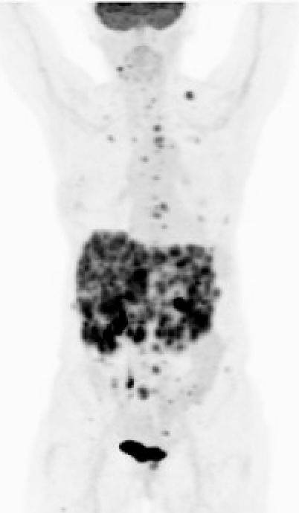
Case Presentation: Dr LaCasce
79-year-old woman who initially noted a neck node in 2025. She then developed shoulder and hip discomfort and was started on 20 mg of prednisone for presumed polymyalgia rheumatica. She then developed abnormal liver function tests and was found to have extensive abnormality within the liver on ultrasound and MRI leading to a biopsy which revealed diffuse large B-cell lymphoma, non-germinal center subtype with a Ki-67 fraction of 80%. PET scan revealed disease replacing much of the liver as well as FDG avid disease within multifocal bony sites as well as small volume nodes in the cervical and supraclavicular regions. IPI was a 4 with LDH 366. In February 2026, she initiated polatuzumab plus R CHP chemotherapy. After 3 cycles of treatment, she is in a metabolic complete remission and will complete her therapy next week.
Baseline PET

Slide 12
Which first-line therapy would you generally recommend for an otherwise healthy patient with Stage IV activated B-cell (ABC)-type DLBCL with an IPI score of 3?
65-year-old
80-year-old
R-CHP + polatuzumab vedotin
Dose-reduced R-CHP + polatuzumab vedotin
R-CHP + polatuzumab vedotin
R-CHP + polatuzumab vedotin
R-CHP + polatuzumab vedotin
R-mini-CHP + polatuzumab vedotin
R-CHP + polatuzumab vedotin
R-mini-CHP + polatuzumab vedotin
R-CHP + polatuzumab vedotin
R-mini-CHP + polatuzumab vedotin
R-CHP + polatuzumab vedotin
R-mini-CHP + polatuzumab vedotin
R-CHP + polatuzumab vedotin
R-mini-CHP + polatuzumab vedotin
R-CHP + polatuzumab vedotin
R-mini-CHP + polatuzumab vedotin

Slide 13
Which first-line therapy would you generally recommend for an otherwise healthy patient with Stage IV germinal center B-cell (GCB)-type diffuse large B-cell lymphoma (DLBCL) with an International Prognostic Index (IPI) score of 3?
65-year-old
80-year-old
R-CHP + polatuzumab vedotin
Dose-reduced R-CHP +
polatuzumab vedotin
R-CHP + polatuzumab vedotin
R-CHP + polatuzumab vedotin
R-CHP + polatuzumab vedotin
R-mini-CHOP
R-CHP + polatuzumab vedotin
R-mini-CHP + polatuzumab vedotin
R-CHP + polatuzumab vedotin
R-mini-CHP + polatuzumab vedotin
R-CHP + polatuzumab vedotin
R-mini-CHP + polatuzumab vedotin
R-CHP + polatuzumab vedotin
R-mini-CHP + polatuzumab vedotin
R-CHOP
R-mini-CHOP
R-CHP = rituximab/cyclophosphamide/doxorubicin/prednisone; R-mini-CHOP = rituximab/cyclophosphamide/doxorubicin/vincristine/prednisone (attenuated)

Slide 14
Cases and Discussion Questions
A 76-year-old very fit man presented with throat pain, trouble swallowing. Tonsil biopsy: DLBCL, GCB-type, Ki-67 50%. PET scan showed disease above and below the diaphragm, splenic involvement, IPI 2. Pola-R-CHP just started.
Sean Warsch, MD
How are you selecting patients with newly diagnosed DLBCL for treatment with polatuzumab vedotin/R-CHP?
Given that POLARIX was not powered to look at cell-of-origin subsets, what do you make of those data? Do you use cell of origin to determine who should receive polatuzumab vedotin/R-CHP? Are you using gene expression profiling assays or any other type of testing to aid in this decision?

Slide 15
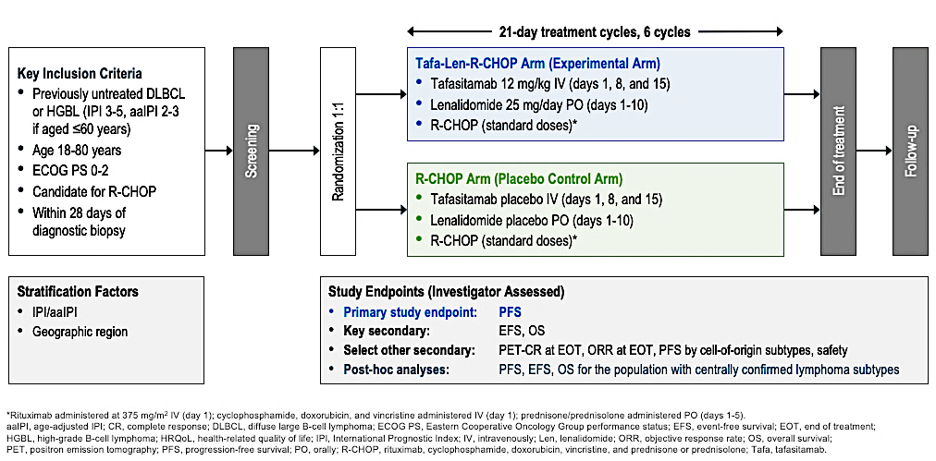
Phase III frontMIND Study Design
Lenz G et al. ASCO 2026;Abstract LBA7000; Lenz G et al. Lancet 2026 June 20;407(10547):2528-41.

Slide 16
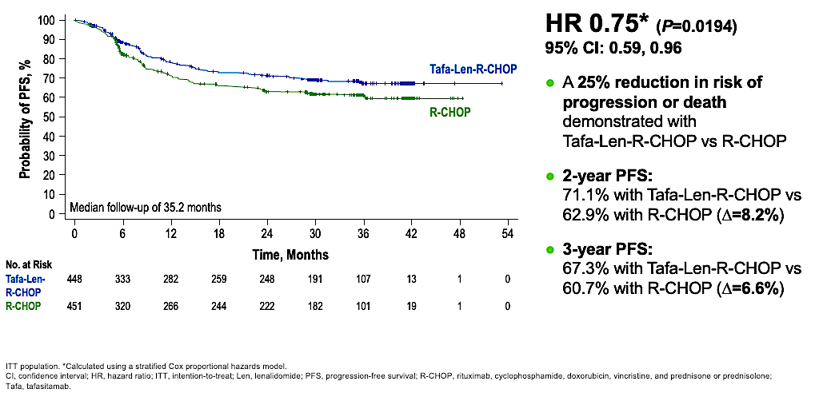
Phase III frontMIND Primary Endpoint: Investigator-Assessed
Progression-Free Survival
In key prespecified subgroup analyses, there are trends toward PFS advantage with Tafa-Len-R-CHOP
Lenz G et al. ASCO 2026;Abstract LBA7000; Lenz G et al. Lancet 2026 June 20;407(10547):2528-41.

Slide 17
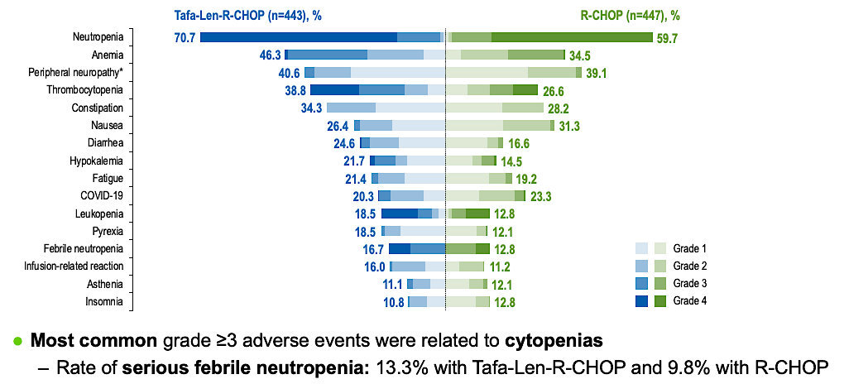
Phase III frontMIND: Most Frequent Treatment-Emergent Adverse Events
Safety events with Tafa-Len-R-CHOP were manageable and did not affect the delivery of the
R-CHOP backbone
Lenz G et al. ASCO 2026;Abstract LBA7000; Lenz G et al. Lancet 2026 June 20;407(10547):2528-41.

Slide 18
PHOENIX: A Phase III Trial of Ibrutinib in Combination with R-CHOP as First-Line Therapy for Non-GCB DLBCL
N = 838 patients randomly assigned to ibrutinib with R-CHOP (n = 419) or placebo with
R-CHOP (n = 419).
Ibrutinib with R-CHOP did not improve EFS in the intent-to-treat (ITT) population (hazard ratio [HR] 0.934) or the activated B-cell (ABC) population (HR 0.949).
For patients younger than 60, ibrutinib with R-CHOP improved EFS (HR 0.579), PFS (HR 0.556), and OS (HR 0.330) and slightly increased serious adverse events (35.7% vs 28.6%), but the proportion of patients receiving at least 6 cycles of R-CHOP was similar between the treatment arms (92.9% vs 93.0%).
Conclusions:
  The study did not meet its primary endpoint in the ITT or ABC population.
  However, patients younger than 60 who received ibrutinib with R-CHOP had significantly improved PFS and OS compared to those receiving R-CHOP alone.
Younes A et al. J Clin Oncol 2019;37:1285-9.

Slide 19
ACCEPT: A Phase Ib/II Study of Acalabrutinib in Combination with
R-CHOP as First-Line Therapy for DLBCL
Clinical outcome | Cohort 1 R-CHOP + acalabrutinib 100 mg once daily (n = 7) |  |  | Cohort 2/Phase II R-CHOP + acalabrutinib 100 mg twice a day (n = 24)
 | ABC (n = 3) | GCB (n = 3) | Total (n = 6) | ABC (n = 12) | GCB (n = 9) | Total (n = 24)
Overall response, (n) | 100% (2) | 67.6% (2) | 83.3% (5) | 91.7% (11) | 100% (9) | 95.8% (23)
Complete response, (n) | 100% (2) | 33.3% (1) | 66.7% (4) | 75% (9) | 100% (9) | 83.3% (20)
Partial response, (n) | 0% | 33.3% (1) | 16.7% (1) | 16.7% (2) | 0% | 12.5% (3)
PFS at 24 months | 80% |  |  | 94.7%
OS at 24 months | 80% |  |  | 95.7%
EFS at 24 months | 60% |  |  | 90.2%
ABC = activated B cell; GCB = germinal center B-cell like; OS = overall survival; EFS = event-free survival
Davies AJ et al. JCO Oncol Adv 2026.

Slide 20
Phase III ESCALADE (ACE-LY-312) Study Design
n = 611
Patients with newly diagnosed non-GCB DLBCL
Acalabrutinib (100 mg BID) + R-CHOP
R-CHOP (cycle 1)
all pts
1:1
Placebo + R-CHOP
All patients will receive primary prophylaxis with
G-CSF accompanying all R-CHOP cycles.
Primary endpoint
PFS
Secondary endpoints
EFS, CR rate, OS, pharmacokinetics, safety
GCB = germinal center B-cell-like; G-CSF = granulocyte-colony stimulating factor; CR = complete response
Sehn LH et al. ASCO 2021;Abstract TPS7572.

Slide 21
Cases and Discussion Questions
A 67-year-old man presents with Stage IV DLBCL involving bulky retroperitoneal adenopathy, spleen, and bone marrow. IPI is 4. FISH is negative for MYC/Bcl-2 rearrangements, but the tumor is double expressor by IHC. ECOG PS is 1 and cardiac function is normal.
Sunil Babu, MD
When are you employing CNS prophylaxis for DLBCL? Would you do so for this patient?
For which patients with newly diagnosed DLBCL do you envision using front-line tafasitamab/lenalidomide/R-CHOP?
What role, if any, do you foresee for BTK inhibitors in DLBCL?

Slide 22
Agenda
Module 4 — Diffuse Large B-Cell Lymphoma: Dr LaCasce
First-Line Treatment
Bispecific Antibodies and CAR T-Cell Therapy

Slide 23
Cases and Discussion Questions
An 82-year-old gentleman received initial treatment with polatuzumab vedotin with dose-adjusted R-CHOP for Stage IV DLBCL with skin involvement. Achieved CR but had recurrence in less than 12 months. He received outpatient epcoritamab step-up dosing. CR, 3 PET scans have all been negative.
Stephen “Fred” Divers, MD
When in the treatment course are you generally administering bispecific antibodies to patients with DLBCL, and how does this vary based on treatment history, patient age/fitness, etc?
Do you adhere to the recommended logistical requirements of the approved bispecifics to the letter? Do you offer treatment breaks to patients who are experiencing a prolonged CR with epcoritamab?

Slide 24
Cases and Discussion Questions
A 74-year-old woman with DLBCL relapses 10 months after first-line therapy. She receives salvage treatment and autologous transplant but progresses again 9 months later. She has mild renal impairment and is not considered an ideal candidate for CAR T because of frailty and limited caregiver support.
Sunil Babu, MD
Would you favor a CD20 x CD3 bispecific in this setting, and how do you choose between them based on efficacy, CRS risk, treatment duration and convenience?
What are your thoughts on recent data combining antibody-drug conjugates and bispecific antibodies for DLBCL? Are you employing any of these regimens, and if so, for when and for whom? What do you make of the emerging data with epcoritamab/lenalidomide? When can you see yourself using that combination?

Slide 25
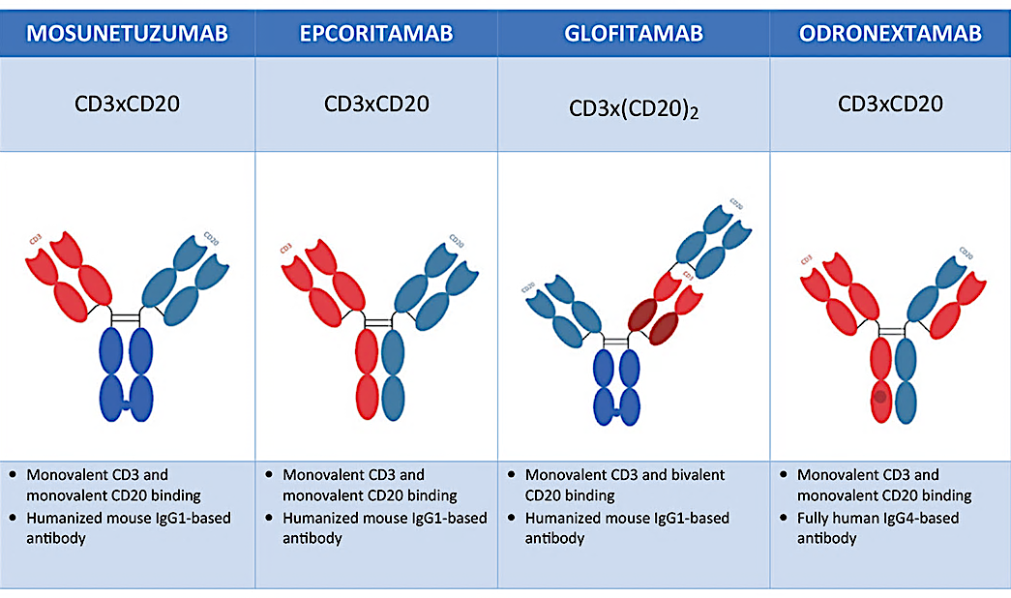
Bispecific Antibodies for DLBCL
Brijs J et al. Belg J Hematol 2023;14(2):67-72.

Slide 26
Glofitamab for Relapsed/Refractory DLBCL Study: Efficacy (IRC and Investigator Assessed)
Clinical outcome | IRC assessment | Investigator assessment
Complete response, % (n) | 39% (61) | 37% (58)
Median duration of complete response, mo | Not reached | 19.8
Objective response, % (n) | 52% (80) | 57% (89)
Median duration of objective response, mo | 18.4 | 10.4
Median PFS, mo | 4.9 | 3.8
Median OS, mo | — | 11.5
Dickinson MJ et al. N Engl J Med 2022 December 15;387(24):2220-31.
IRC = independent review committee

Slide 27
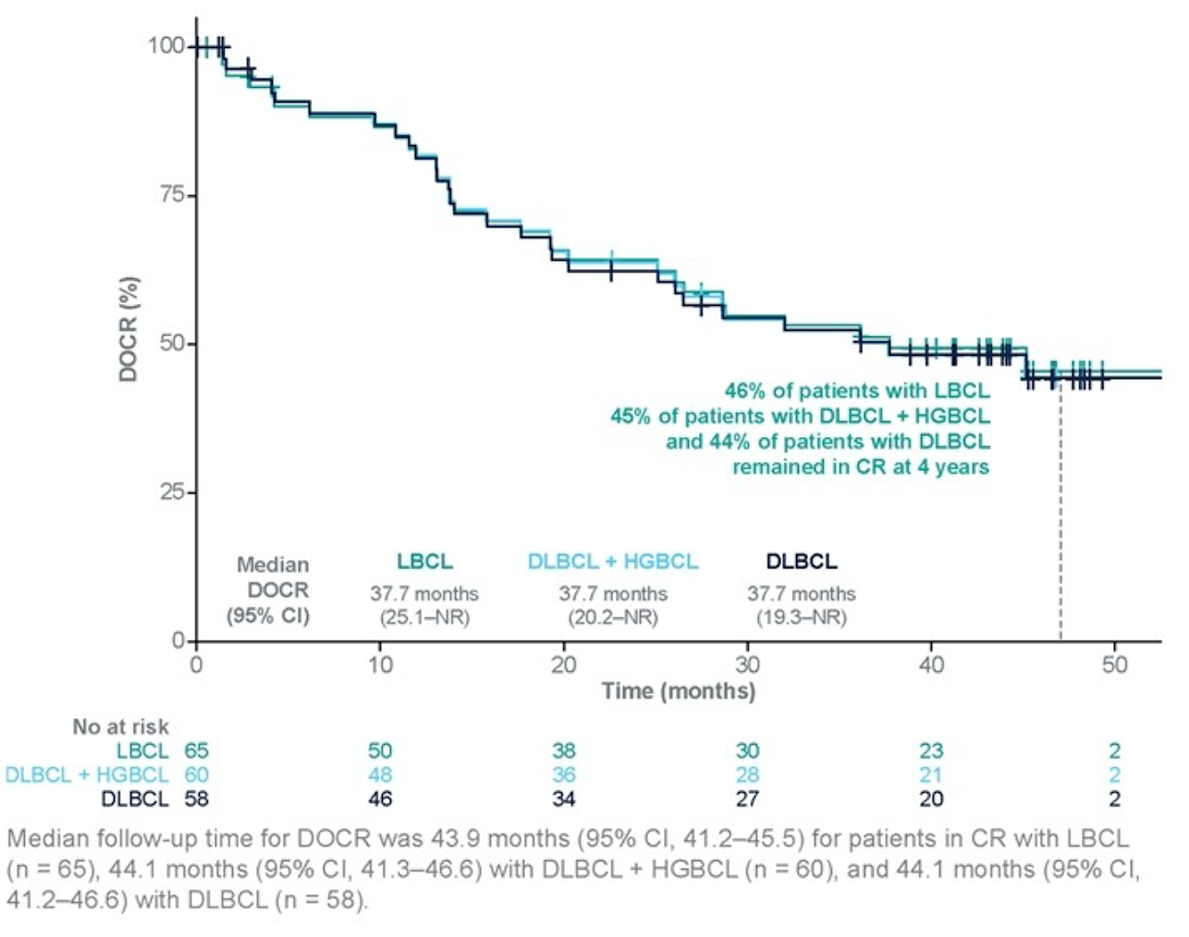
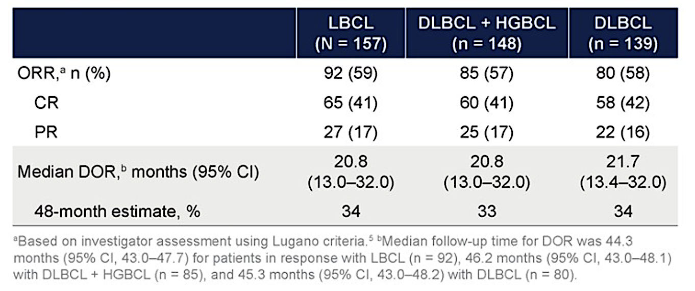
Phase II EPCORE NHL-1 Trial Long-Term Follow-Up: Responses
LBCL = large B-cell lymphoma; HGBCL = high-grade B-cell lymphoma;
ORR = overall response rate; PR = partial response; DOR = duration of response
Thieblemont C et al. EHA 2026;Abstract PF977.

Slide 28
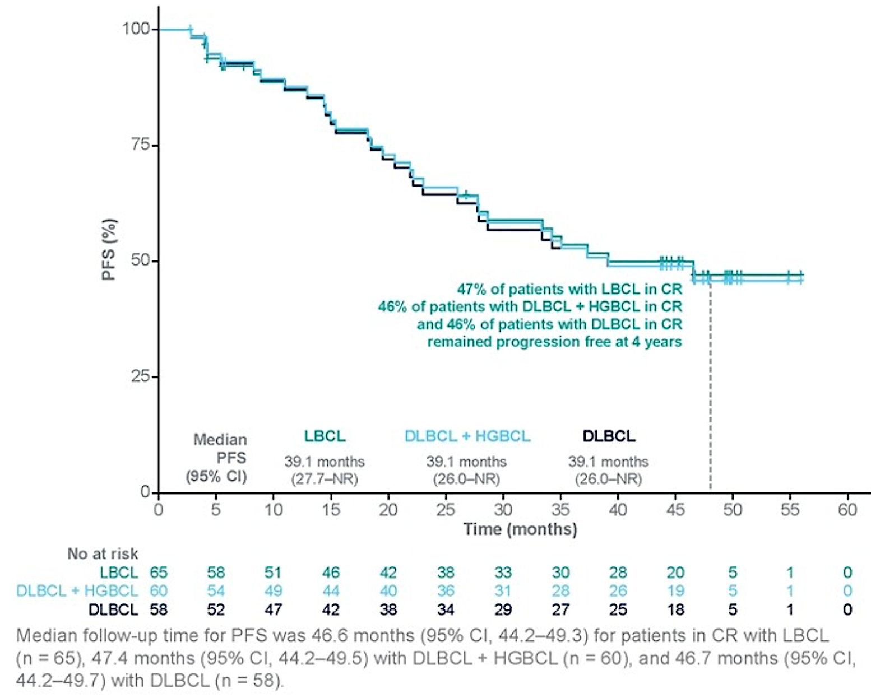
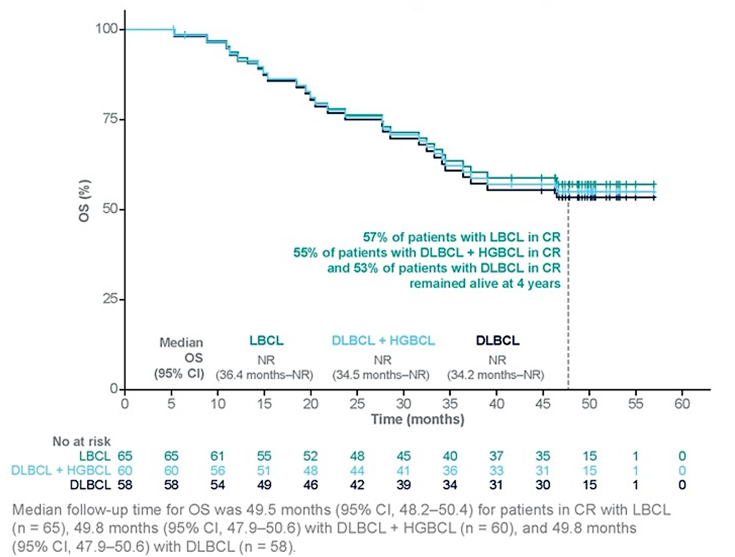
Phase II EPCORE NHL-1 Long-Term Follow-Up: Survival
PFS
OS
Thieblemont C et al. EHA 2026;Abstract PF977.

Slide 29
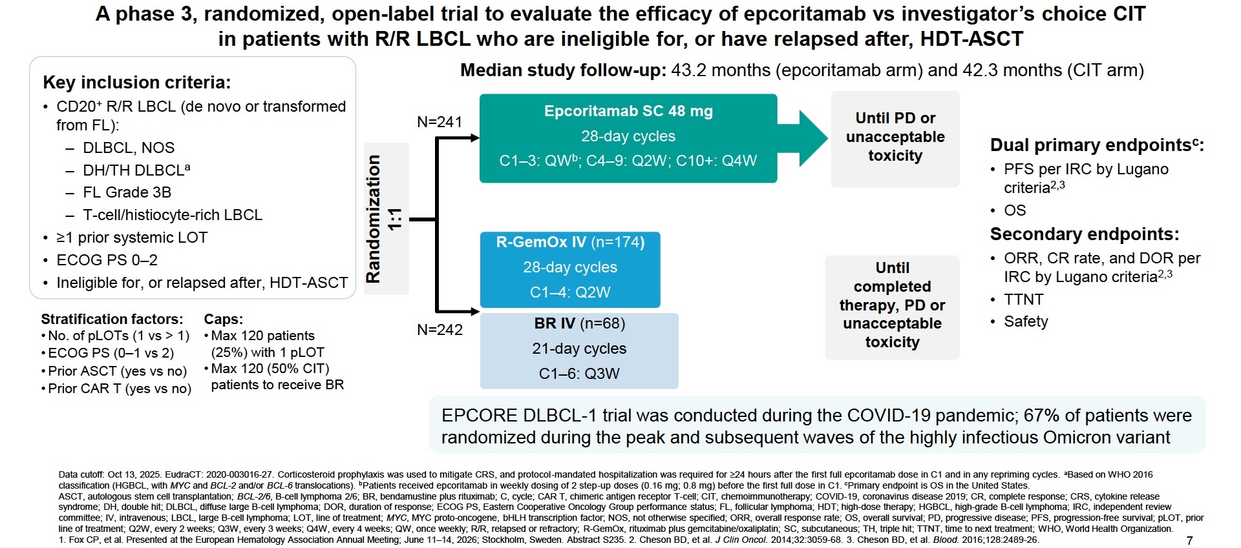
EPCORE DLBCL-1: A Phase III Trial of Epcoritamab versus Investigator’s Choice Chemoimmunotherapy (CIT) for R/R LBCL
Fox CP et al. EHA 2026;Abstract S235.

Slide 30
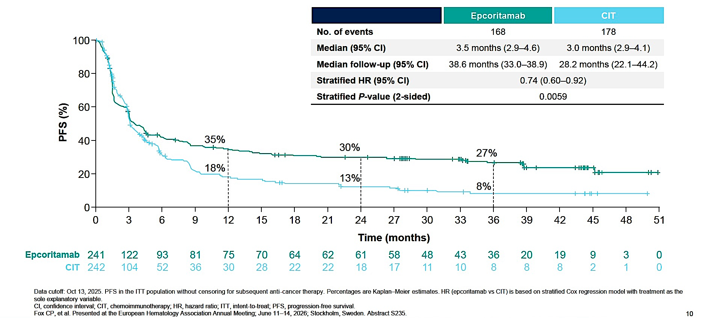
EPCORE DLBCL-1: Efficacy Summary
Epcoritamab resulted in clinically meaningful improvement in CR, DOR and duration of complete response
OS was not significantly different; confounded by COVID-19 mortality and higher use of effective subsequent treatments in the CIT arm
Fox CP et al. EHA 2026;Abstract S235.

Slide 31
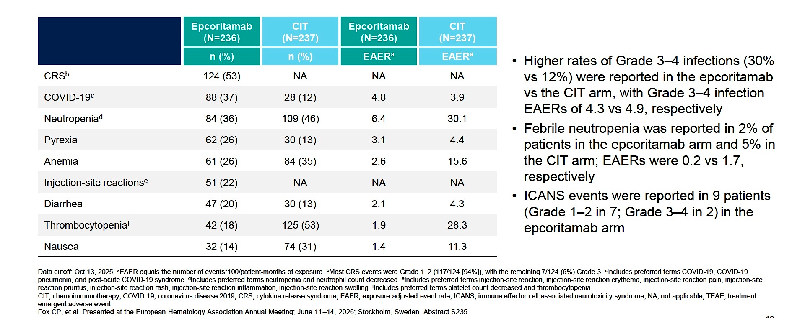
EPCORE DLBCL-1: Most Common Treatment-Emergent Adverse Events
Fox CP et al. EHA 2026;Abstract S235.

Slide 32
Phase III EPCORE DLBCL-4 Study Design
Trial identifier: NCT06508658 (closed)
Eligibility
Histologically confirmed CD20+ DLBCL
Relapsed/refractory disease previously treated with at least 1 line of systemic antineoplastic therapy, including anti-CD20 mAb-containing combination chemotherapy
Failure of prior ASCT or ASCT ineligible
CAR T-cell therapy ineligible
Arm A
Subcutaneous epcoritamab + oral lenalidomide
Arm B
IV R-GemOx (rituximab/gemcitabine/
oxaliplatin)
R
Arm C
Subcutaneous epcoritamab
Primary endpoint (Arm A vs Arm B): Progression-free survival
Secondary endpoints (Arm A vs Arm B): Complete response, overall survival, minimal residual disease negativity rate
www.clinicaltrials.gov. Accessed August 2026.

Slide 33
Positive Phase III Results Announced for Epcoritamab with Lenalidomide for Patients with Relapsed or Refractory DLBCL
Press Release: June 29, 2026
“[The manufacturer] today announced topline results from the Phase 3 EPCORE DLBCL-4 trial evaluating the combination of epcoritamab, a T-cell engaging bispecific antibody, and lenalidomide, compared to rituximab plus gemcitabine plus oxaliplatin (R-GemOx) in adult patients with relapsed or refractory (R/R) diffuse large B-cell lymphoma (DLBCL) who received at least one prior line of therapy. Based on topline results from the prespecified primary analysis, the trial met its primary endpoint, demonstrating statistically significant and clinically meaningful improvement in progression-free survival (PFS). The risk of disease progression and death was reduced by 60% (HR 0.40 [95% CI 0.30, 0.55]; p-value <0.0001) and 56% (HR 0.44 [95% CI 0.33, 0.60]; p-value <0.0001), based on different censoring rules in the US and outside the US, respectively.
The safety profile of epcoritamab when administered in combination with lenalidomide was consistent with the known safety profiles of the individual agents (epcoritamab and lenalidomide).
Data will be submitted for presentation at a future medical meeting.”
https://news.abbvie.com/2026-06-29-AbbVie-Announces-Positive-Phase-3-Results-for-Epcoritamab-Plus-Lenalidomide-in-Patients-with-Relapsed-or-Refractory-Diffuse-Large-B-Cell-Lymphoma

Slide 34
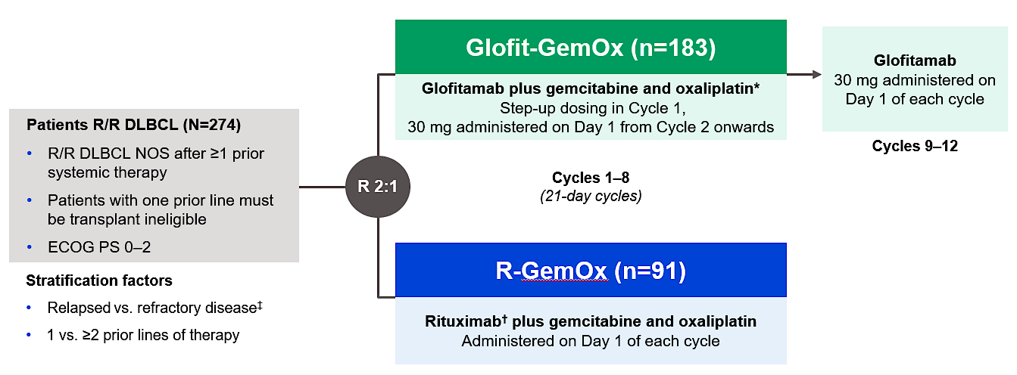
Phase III STARGLO Study Design
Primary endpoint:
Overall survival
Secondary endpoints:
Progression-free survival, objective response rate, DoR
Abramson JS et al. Lancet 2024 November 16;404(10466):1940-54.

Slide 35
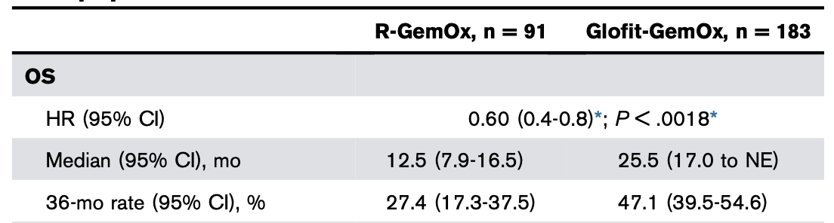
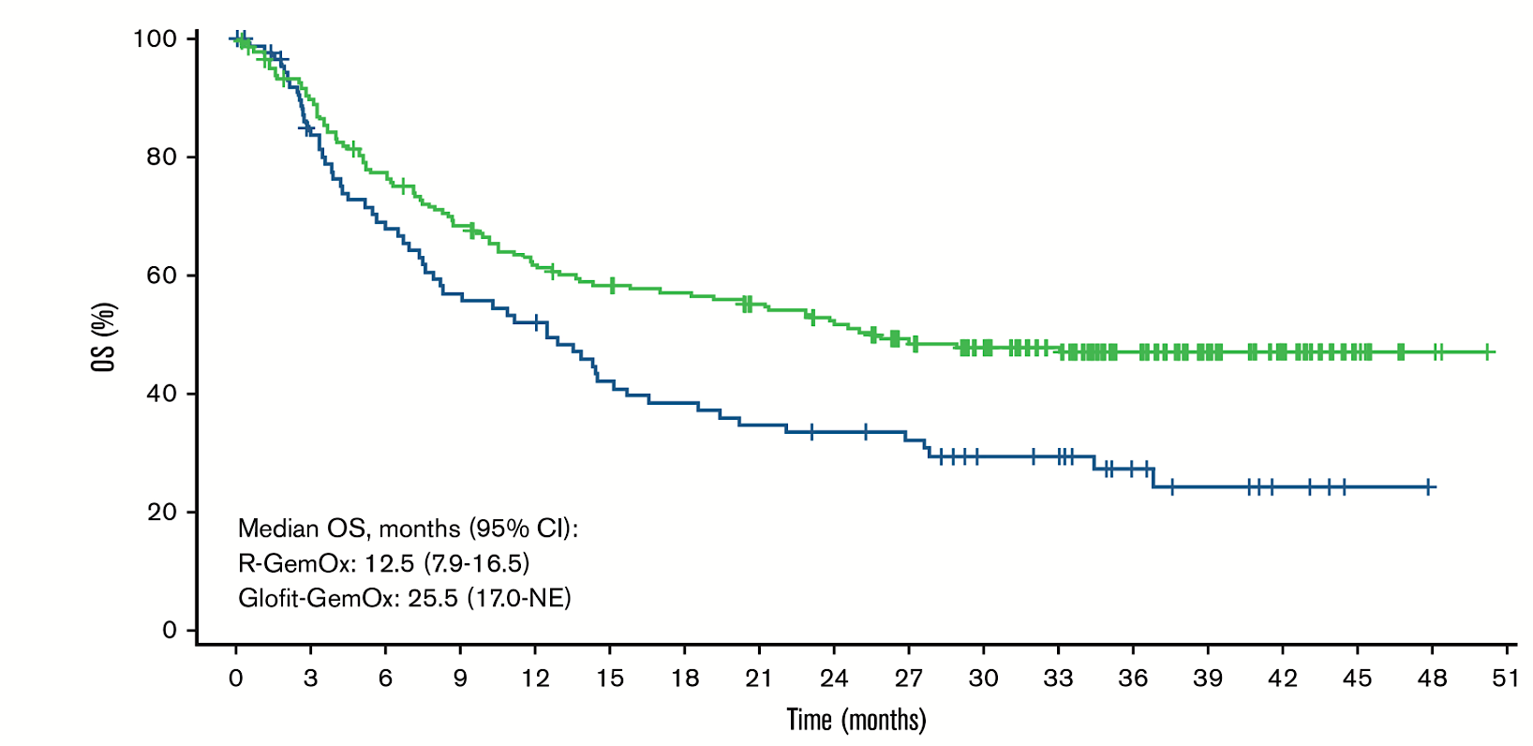
Phase III STARGLO 3-Year Follow-Up: OS (Primary Endpoint)
Abramson JS et al. Blood Adv 2026 August 11;10(15):5367-77.

Slide 36
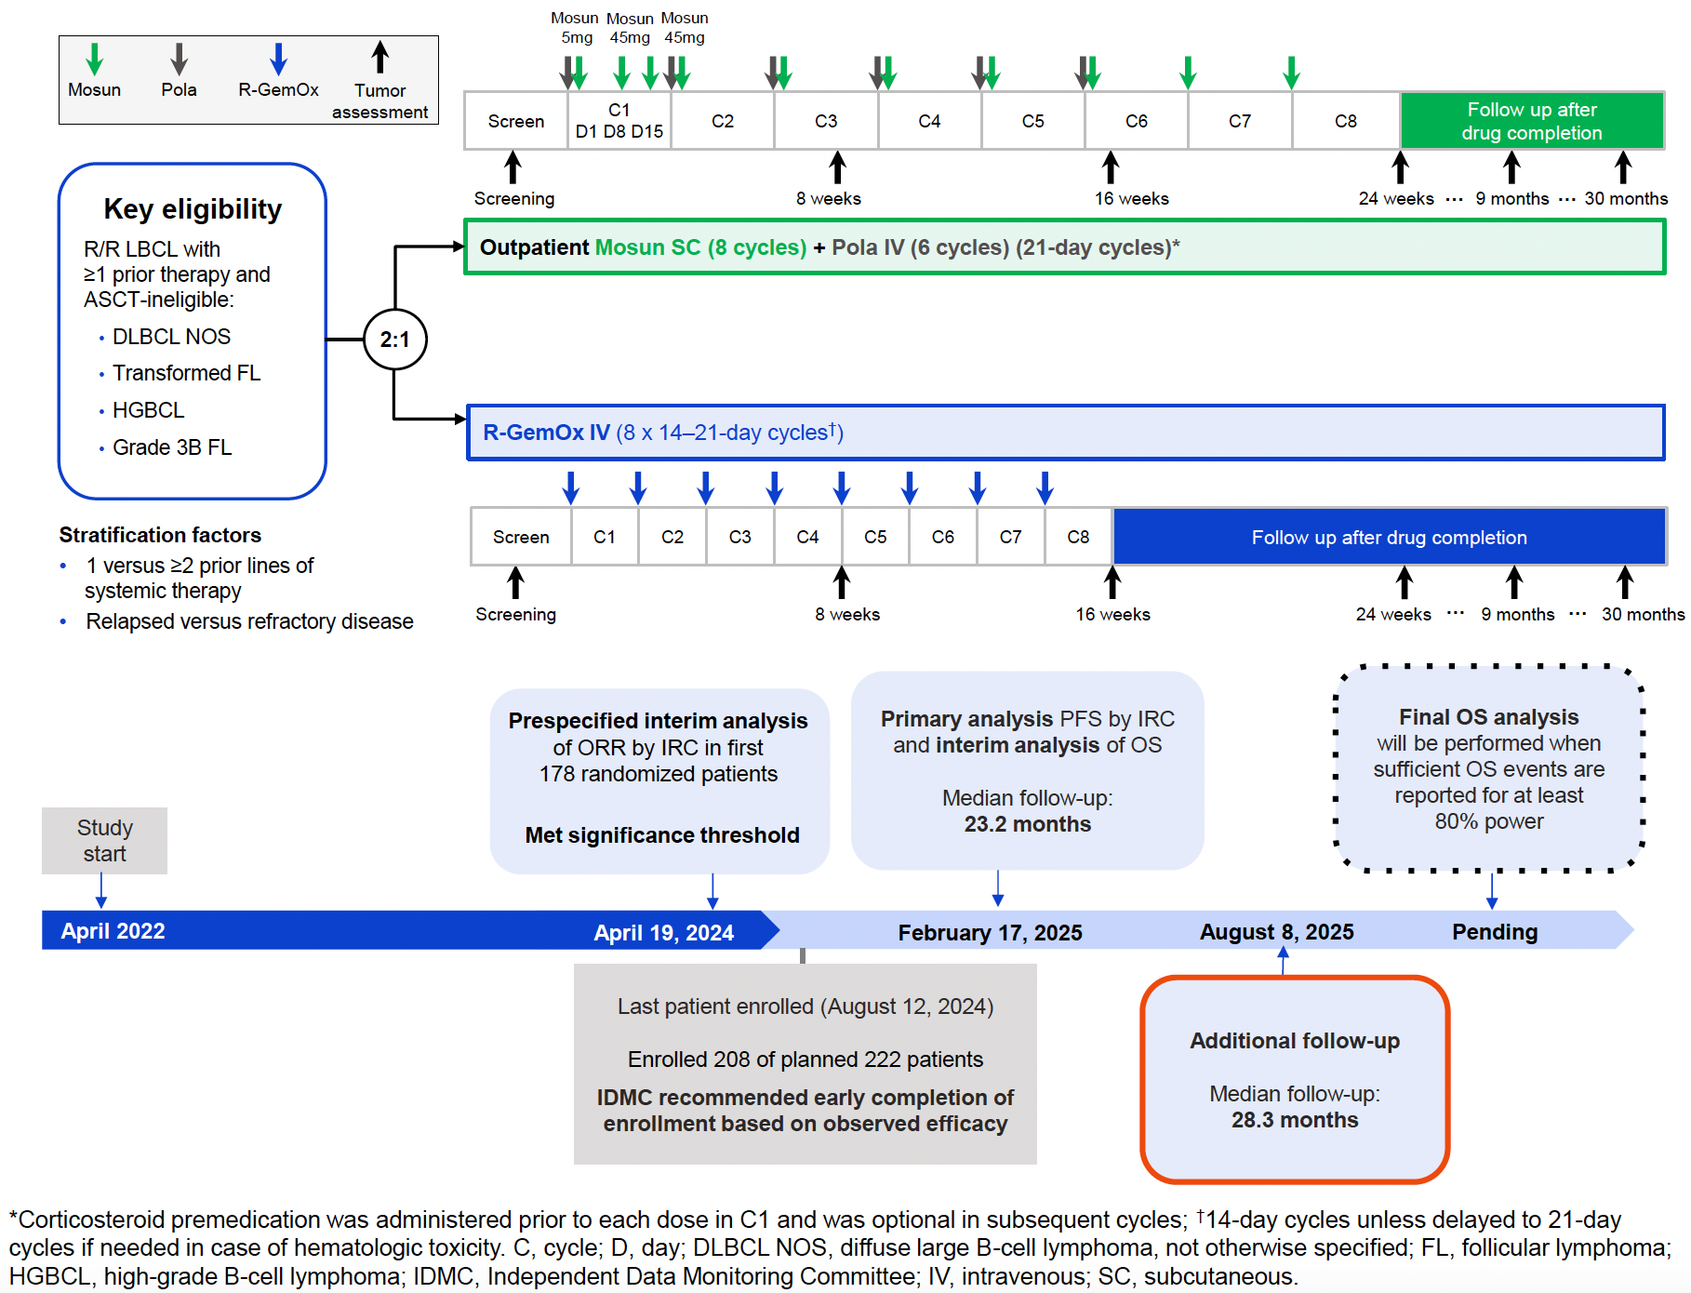
Phase III SUNMO Study Design
Budde LE et al. EHA 2026;Abstract PF968.

Slide 37
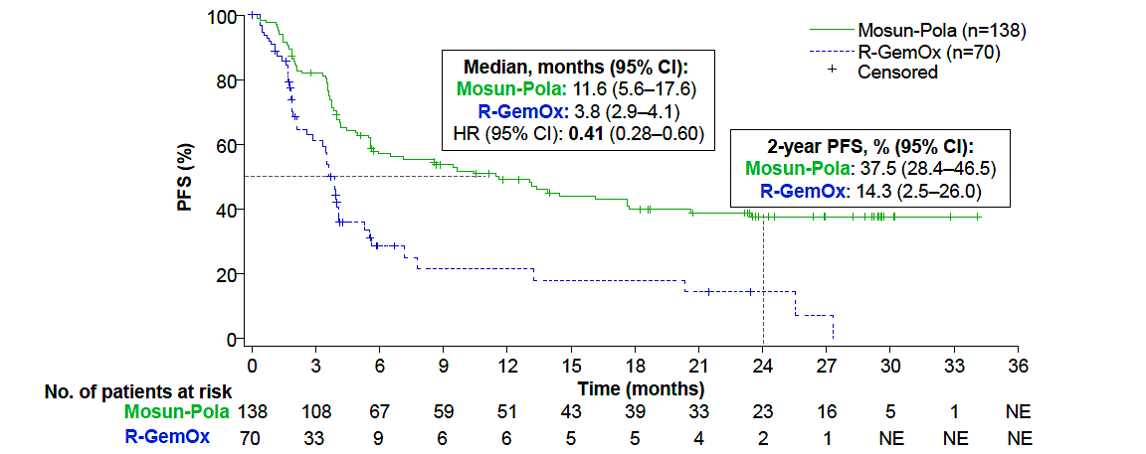
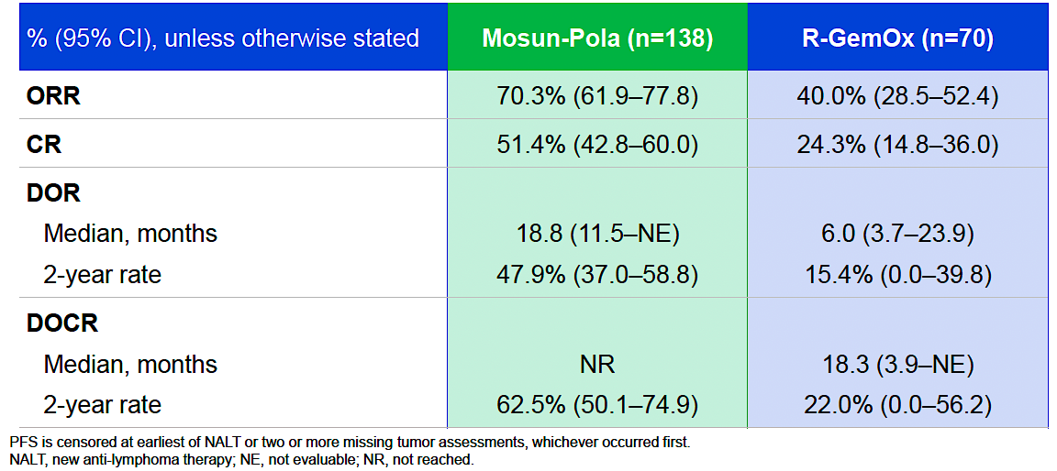
Phase III SUNMO: PFS, ORR (Dual Primary Endpoints)
Budde LE et al. EHA 2026;Abstract PF968.
ORR = objective response rate

Slide 38
Select Ongoing Trials of Epcoritamab and Glofitamab for Newly Diagnosed DLBCL
Trial identifier | Phase | Treatment arms | Primary completion date
EPCORE DLBCL-2 (NCT05578976) | III | Epcoritamab + R-CHOP followed by epcoritamab R-CHOP followed by rituximab | June 2027
SKYGLO (NCT06047080) | III | Glofitamab + pola-R-CHP Pola-R-CHP | October 2027
www.clinicaltrials.gov. Accessed August 2026.

Slide 39
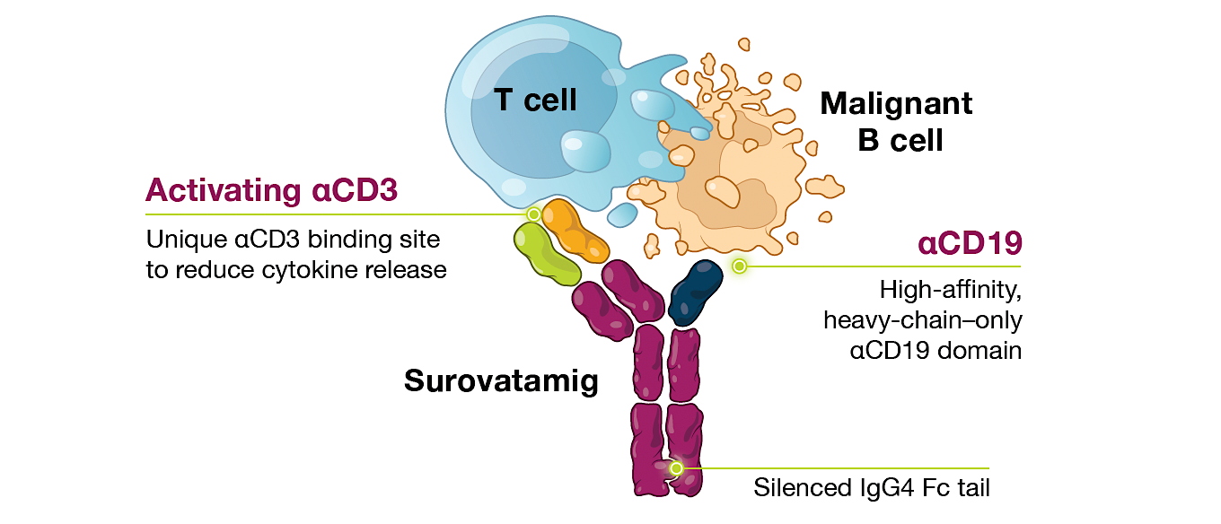
Surovatamig (AZD0486): A CD19 x CD3 Bispecific T-Cell Engager
Cheah C et al. ASH 2025;Abstract 3747.

Slide 40
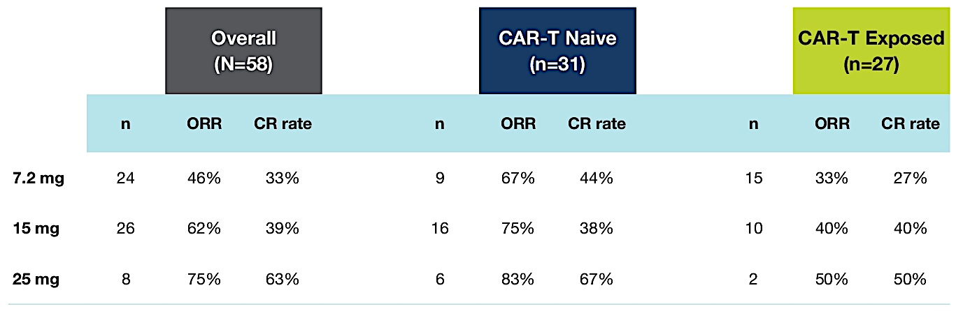
Phase I Surovatamig Study: Responses by Target Dose (≥7.2 mg)
Kim TM et al. ASCO 2025;Abstract 7046.

Slide 41
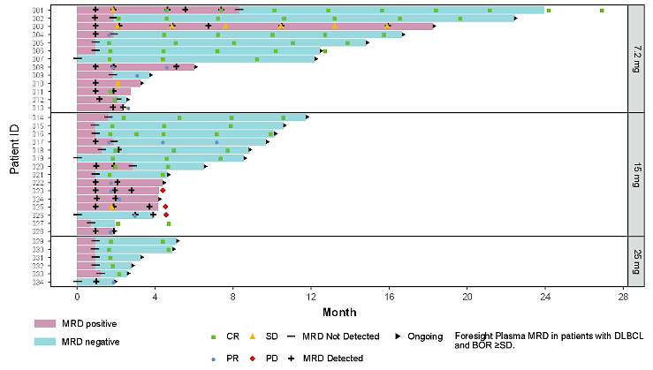
Phase I Surovatamig Study: MRD in Plasma by Target Dose (≥7.2 mg)
MRD = minimal residual disease
Kim TM et al. ASCO 2025;Abstract 7046.

Slide 42
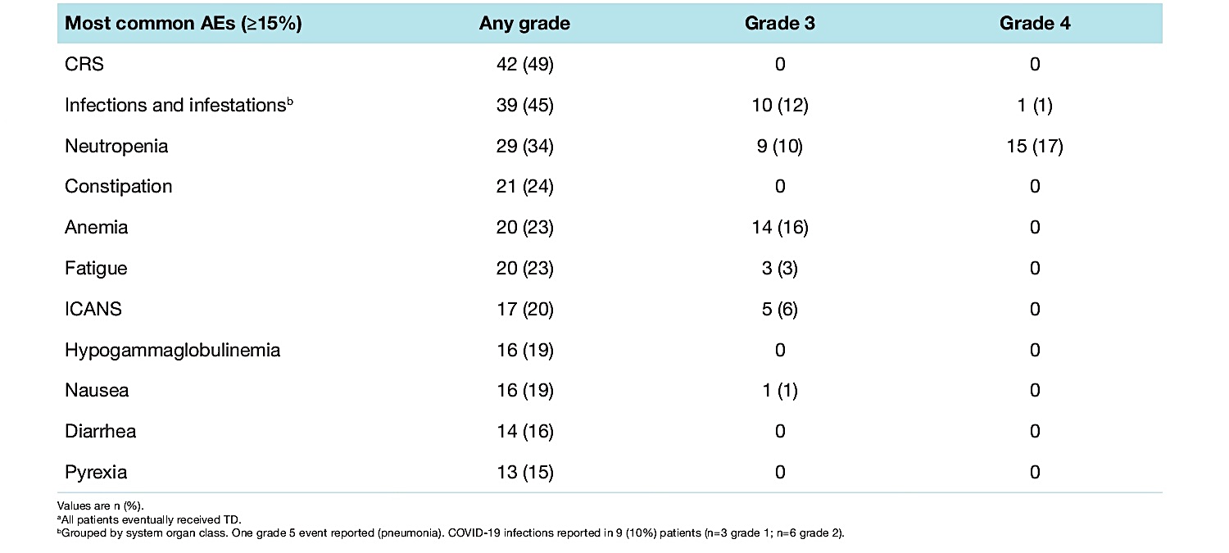
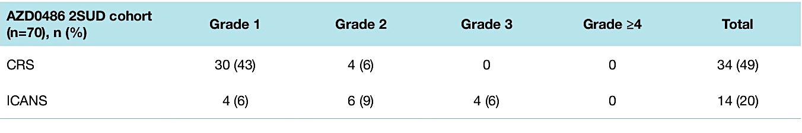
Phase I Surovatamig Study: Safety
AEs = adverse events; CRS = cytokine release syndrome; ICANS = immune effector cell-associated neurotoxicity syndrome
Kim TM et al. ASCO 2025;Abstract 7046.

Slide 43
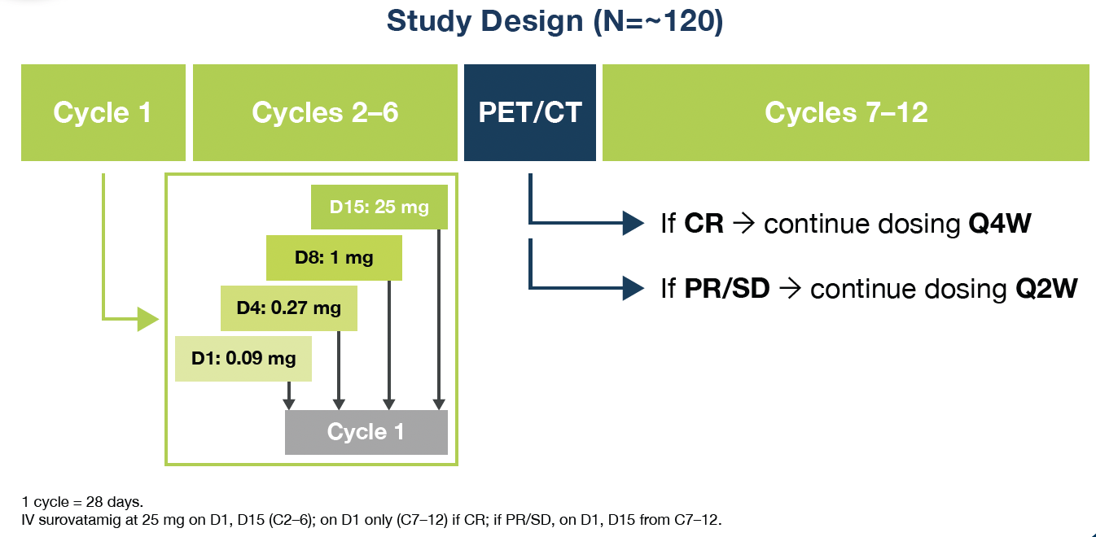
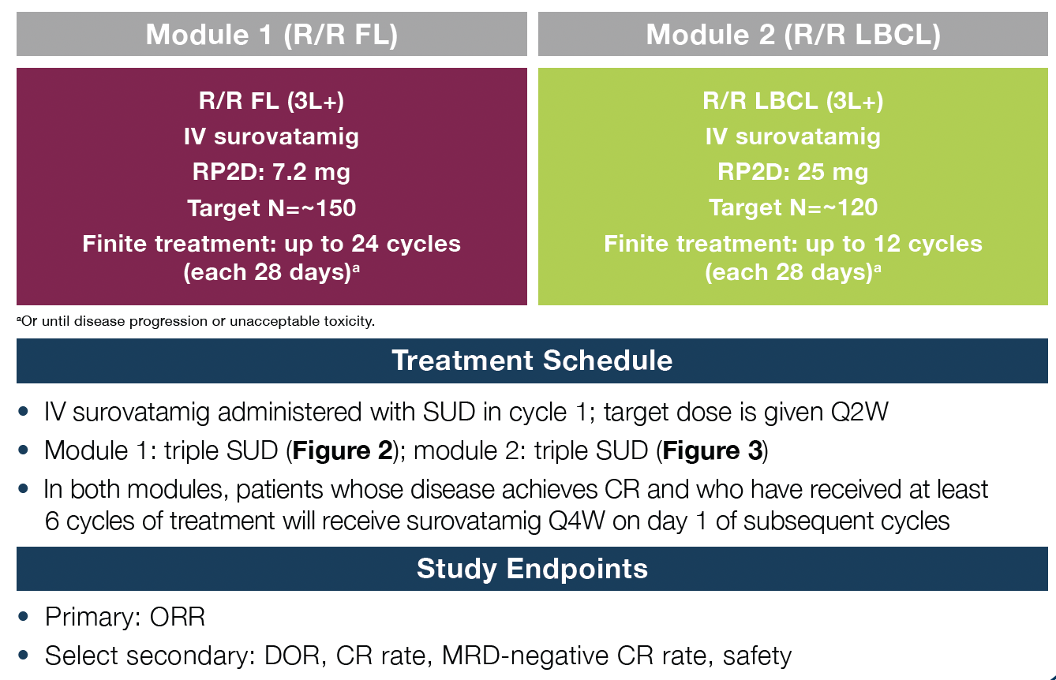
Ongoing Phase II SOUNDTRACK-B Study
Module 2
Cheah C et al. ASH 2025;Abstract 3747.

Slide 44
Ongoing Phase III SOUNDTRACK-D2 Study
Estimated primary completion date: 10 Jun 2030
n = 420 (est.)
Elderly or unfit patients with newly diagnosed LBCL
Surovatamig (RP3D) + R-mini-CHOP*
* Patients will receive 2 cycles of R-mini-CHOP prior to experimental treatment
R
R-mini-CHOP x 6 cycles
Primary endpoints
Safety, RP3D, PFS (Lugano 2014 criteria)
Secondary endpoints
Safety run-in: ORR, CR, DoR, DoCR, PFS, OS
Phase III: PFS2, TFST, Safety, PROs
Experimental safety run-in:
Surovatamig (RP2D) + R-mini-CHOP*
* Patients will receive 2 cycles of R-mini-CHOP prior to experimental treatment
RP3D = recommended Phase III dose; ORR = overall response rate; CR = complete response; DoCR = duration of complete response; PFS2 = time from randomization to second disease progression or death; TFST = time to subsequent therapy or death; PROs = patient-reported outcomes; RP2D = recommended Phase II dose
www.clinicaltrials.gov. NCT07215585. Accessed August 2026.

Slide 45
Based on the published literature and your clinical experience, would you like to have access to surovatamig for your patients with R/R DLBCL today?
Yes, for patients with CD20-negative disease
Yes, as part of second-line combinations prior to CAR T; third-line+ relapse
Yes, for CAR T-ineligible pts in the second-line setting
Yes, for patients who are ineligible for CD19 CAR T
No
Yes, after CAR T-cell therapy
Yes, for patients with PD on CD3 x CD20 combinations or monotherapy,
and for those with CD20-negative disease
Yes, for patients with CD20 loss and non-CAR T eligible

Slide 46
If surovatamig were granted regulatory approval, would you employ a CD20 x CD3 bispecific antibody and surovatamig in sequence for the same patient with R/R DLBCL?
Yes
Yes
Yes
Maybe
Yes
Yes
Yes
Yes

Slide 47
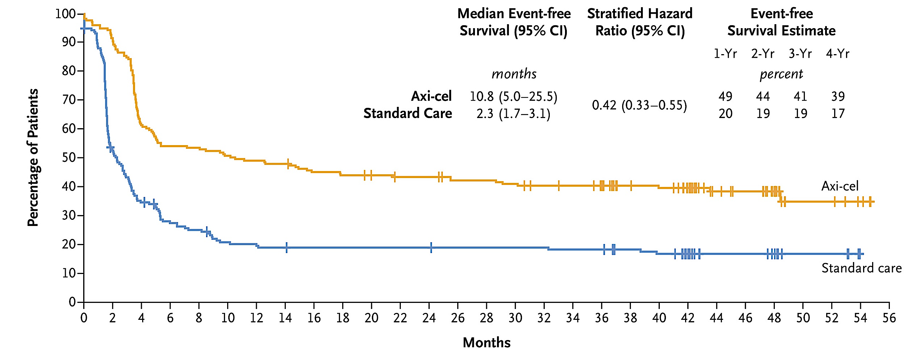
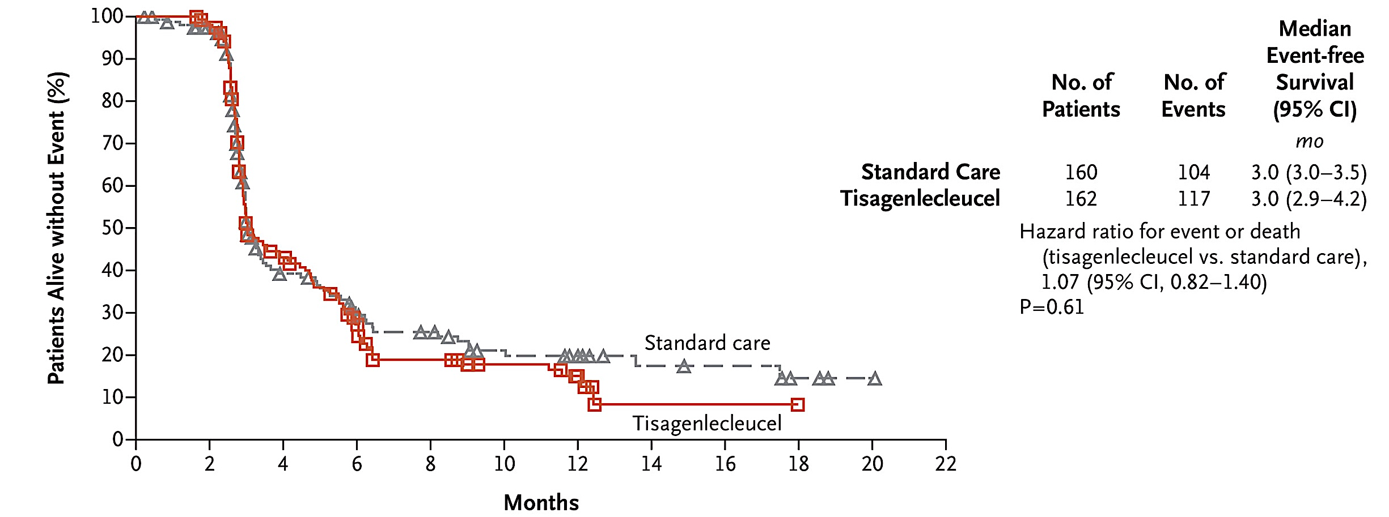
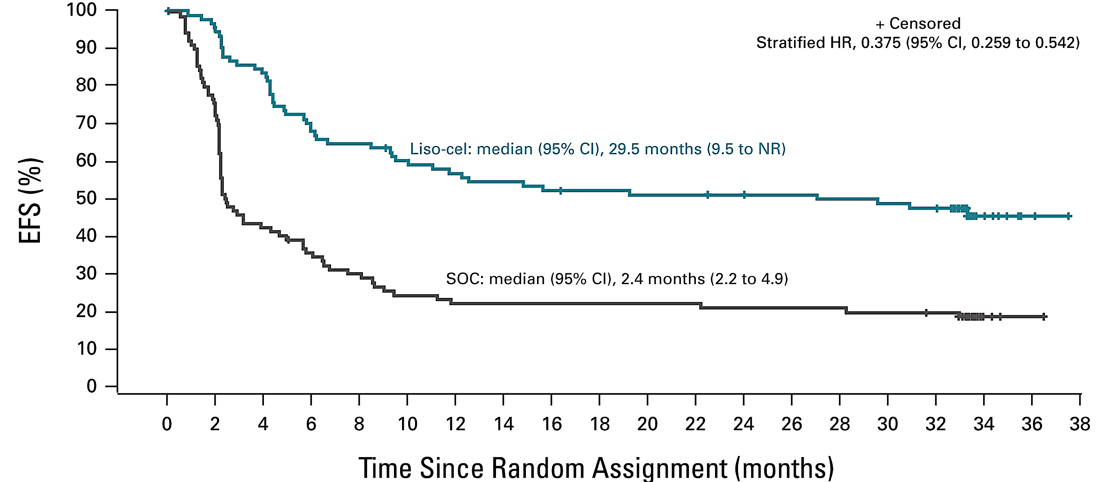
Long-Term EFS with CD19-Directed CAR T-Cell Therapy for DLBCL
mEFS (mo) | CAR-T Tx (95% CI) | SC (95% CI) | HR (95% CI)
BELINDA (tisa-cel) | 3.0 (2.9-4.2) | 3.0 (3.0-3.5) | 1.07 (0.82-1.40)
TRANSFORM (liso-cel) | 29.5 (9.5-NR) | 2.4 (2.2-4.9) | 0.375 (0.259-0.542)
ZUMA-7 (axi-cel) | 10.8 (5.0-25.5) | 2.3 (1.7-3.1) | 0.42 (0.33-0.55)
EFS = event-free survival; CAR = chimeric antigen receptor; SC = standard care
Westin JR et al. N Engl J Med 2023 July 13;389(2):148-57.
Kamdar M et al. Clin Oncol 2025 August 20;43(24):2671-78.
Bishop MR et al. N Engl J Med 2022 February 17;386(7):629-39.

Slide 48
Case Presentation: Dr LaCasce
88-year-old male who was initially diagnosed with diffuse large B-cell lymphoma, germinal center subtype involving the bilateral neck and right axilla in August 2024, IPI 2. He was initially treated with R mini-CHOP, 75% dose. Interim PET after 3 cycles showed improvement, but following the last cycle of therapy, he developed a rapidly progressive left orbital lesion. Given the concern for impending visual loss, he received radiotherapy to a total dose of 1400 cGy. He then initiated glofitamab, plus gemcitabine and oxaliplatin. He completed all 12 cycles of therapy and achieved an early metabolic complete remission. Unfortunately, on restaging after completion of treatment, he developed a new right sided pleural-based lesion and rapidly developed a large effusion. Pleural fluid confirmed disease that was both CD19 and CD20 negative.

Slide 49
Cases and Discussion Questions
A 58-year-old man with primary refractory DLBCL progresses during first-line therapy. He has rapidly enlarging abdominal adenopathy but remains ECOG 1 with preserved organ function.
Sunil Babu, MD
Would you proceed directly toward second-line CAR T, and how do you approach bridging therapy in a patient with rapidly progressive disease while awaiting collection and infusion?
How do you choose between axicabtagene ciloleucel and lisocabtagene maraleucel in this scenario? In your experience, does either of these products have substantially better responses than the other in the second line? What about survival outcomes?

Slide 50
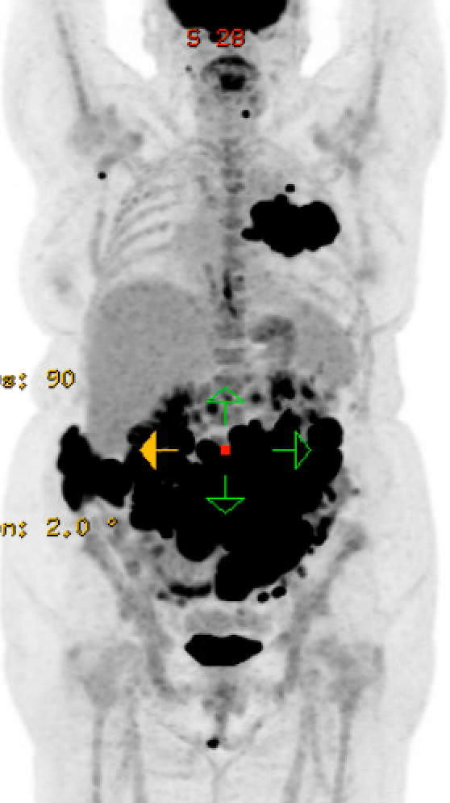
Case Presentation: Dr LaCasce
67-year-old Jehovah's Witness initially presented with neck adenopathy. She eventually underwent an excisional lymph node biopsy in October of 2023 which revealed diffuse large B-cell lymphoma, germinal center subtype in a background of follicular lymphoma. She had a BCL6 arrangement without MYC or Bcl-2 rearrangements. She had stage III disease with adenopathy above and below the diaphragm. Her IPI was a 3. She received 6 cycles of R-CHOP completed in February 2024. She presented in late 2025 with abdominal symptoms and was found to have extensive disease recurrence in the abdomen involving the small bowel, lymph nodes and with a large left-sided lung mass. Biopsy confirmed CD10 positive diffuse large B-cell lymphoma. She was treated with 1 cycle of polatuzumab, R gem ox followed by T-cell pheresis. She was then admitted to the hospital for rapid glofitamab ramp-up. Prior to CAR-T cell therapy she had a dramatic response by CT scans. She subsequently received
liso-cel and had no CRS or neurologic toxicity. Her day 30 PET scan shows a metabolic complete remission.
January 2026

Slide 51
Up Next …
Dr Stephen V Liu discusses the management of lung cancer

Slide 52
Integrating New Advances into
Community Oncology Practice
A Multitumor Symposium Hosted in Conjunction with the American Oncology Network
CME/MOC, NCPD and ACPE Accredited
Saturday, August 22, 2026
9:00 AM – 2:20 PM CT

Slide 53
Agenda
Module 1 — Chronic Lymphocytic Leukemia
Farrukh T Awan, MD, MS, MBA
Module 2 — Gastroesophageal Cancers
Samuel J Klempner, MD
Module 3 — Ovarian and Endometrial Cancer
Shannon N Westin, MD, MPH, FASCO, FACOG
Module 4 — Diffuse Large B-Cell Lymphoma
Ann LaCasce, MD, MMSc
Module 5 — Lung Cancer
Stephen V Liu, MD

Slide 54

Lung Cancer Faculty
Stephen V Liu, MD
Chief of the Division of Hematology
and Oncology
Associate Professor of Medicine
Georgetown University Hospital
Washington, DC
MODERATOR
Stephen “Fred” Divers, MD
Chief Medical Officer
American Oncology Network
Board Executive
Community Oncology Alliance
Hot Springs, Arkansas

Slide 55
Dr Liu — Disclosures
Consulting Agreements | AbbVie Inc, Amgen Inc, AstraZeneca Pharmaceuticals LP, Boehringer Ingelheim Pharmaceuticals Inc, Bristol Myers Squibb, Daiichi Sankyo Inc, Ellipses Pharma, Genentech, a member of the Roche Group, Gilead Sciences Inc, GSK, Jazz Pharmaceuticals Inc, Johnson & Johnson, Merck, Merus, Natera, Novartis, Nuvalent, OSE Immunotherapeutics, Pfizer Inc, PharmaMar, Regeneron Pharmaceuticals Inc, Revolution Medicines Inc, Rigel Pharmaceuticals Inc, SystImmune Inc, Takeda Pharmaceuticals USA Inc, Yuhan Corporation
Contracted Research | AbbVie Inc, Alkermes, Amgen Inc, AstraZeneca Pharmaceuticals LP, Avenzo Therapeutics, BioNTech SE, Cogent Biosciences, Duality Biologics, Ellipses Pharma, Genentech, a member of the Roche Group, Gilead Sciences Inc, Henlius, MediLink Therapeutics, Merck, Merus, Nuvalent, Nuvation Bio Inc, OSE Immunotherapeutics, Puma Biotechnology Inc, Synthekine, SystImmune Inc

Slide 56
Dr Divers — Disclosures
Advisory Committees | Daiichi Sankyo Inc

Slide 57
Snapshot of AON Practice
Non-Small Cell Lung Cancer

Slide 58
Snapshot of AON Practice
NSCLC with EGFR Mutation

Slide 59
Snapshot of AON Practice
NSCLC with ALK Rearrangement

Slide 60
Snapshot of AON Practice
NSCLC with ROS1 Rearrangement

Slide 61
Snapshot of AON Practice
NSCLC with KRAS Mutation

Slide 62
Snapshot of AON Practice
NSCLC with HER2 Alterations

Slide 63
Snapshot of AON Practice
NSCLC with MET Alterations

Slide 64
Snapshot of AON Practice
Small Cell Lung Cancer (SCLC)

Slide 65
Snapshot of AON Practice
SCLC — Immunotherapy

Slide 66
Snapshot of AON Practice
SCLC — Other Treatments

Slide 67
Agenda
Module 5 — Lung Cancer: Dr Liu
EGFR Mutations
HER2 Alterations
ALK Fusions
Available and Investigational Immunotherapies
Small Cell Lung Cancer

Slide 68
Cases and Discussion Questions
74-year-old woman with a PMH of breast cancer is diagnosed with EGFR exon 21 L858R-mutant metastatic NSCLC. S/p first-line carboplatin/pemetrexed/
osimertinib. Currently receiving Dato-DXd and doing well.
Stephen “Fred” Divers, MD
How do you select first-line treatment for EGFR-mutant metastatic NSCLC?
How do you select second- and later-line treatment for EGFR-mutant metastatic NSCLC, and how does that vary based on the specific first-line therapy received? How does the duration of response to up-front therapy affect your decision?

Slide 69
Cases and Discussion Questions (Continued)
Where in the treatment sequence are you most likely to employ datopotamab deruxtecan (Dato-DXd) for patients with EGFR-mutated NSCLC? Are you comfortable using it for patients with uncommon EGFR mutations?
In your experience, how does the global tolerability of Dato-DXd compare to that of traditional chemotherapy? Is it better tolerated or about the same?
What prophylactic measures do you recommend for your patients who are about to start treatment with Dato-DXd to reduce the risk of side effects?

Slide 70
Cases and Discussion Questions (Continued)
Do you always rebiopsy after disease progression on first-line osimertinib with or without chemotherapy? How often do you encounter patients with MET overexpression or amplification in this scenario?
How do you envision osimertinib/savolitinib fitting in relative to other available therapies for these patients?

Slide 71
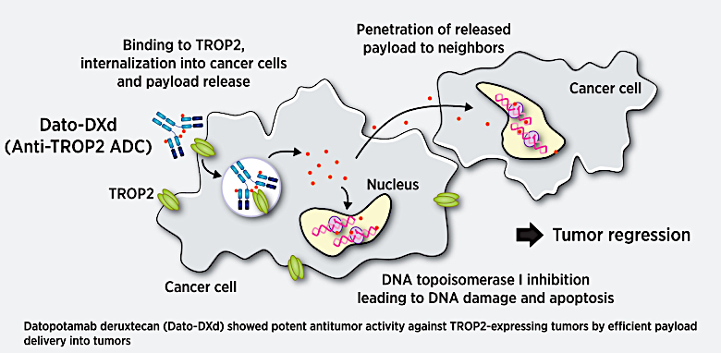
TROP2-Targeting Antibody-Drug Conjugates (ADCs) for Non-Small Cell Lung Cancer (NSCLC)
TROP2 is an intracellular calcium-signaling transducer that is overexpressed in epithelial cancers, including NSCLC.
Kuo P et al. PLoS One 2025;20(4):e0321555. Okajima D et al. Mol Cancer Ther 2021;20(12):2329-40.

Slide 72
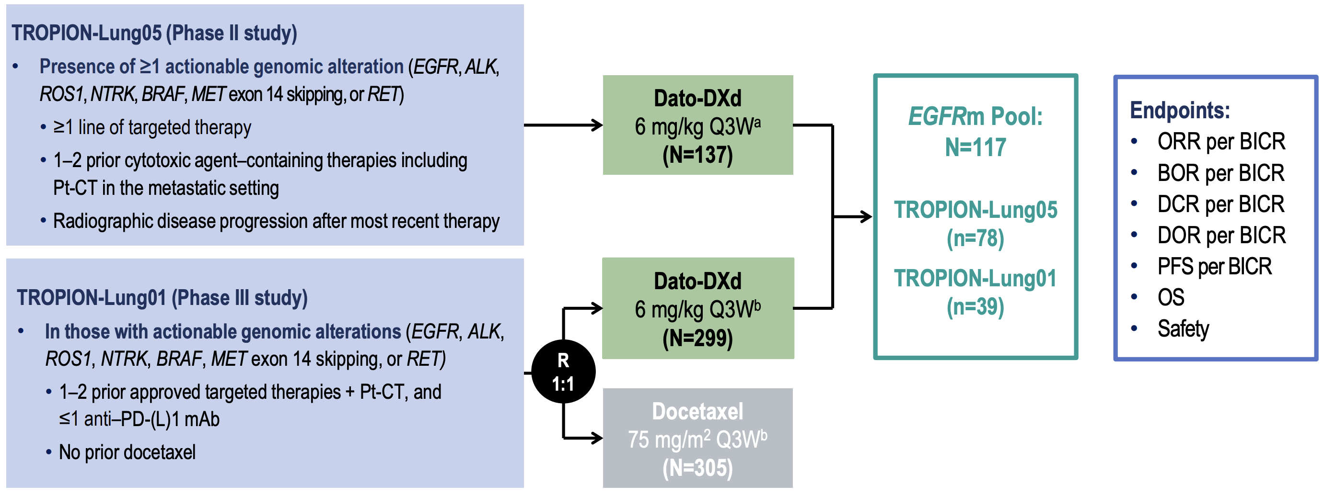
Datopotamab Deruxtecan (Dato-DXd) for EGFR-Mutated NSCLC: Pooled Analysis from the TROPION-Lung01 and TROPION-Lung05 Studies
Pt-CT = platinum chemotherapy; ORR = objective response rate; BICR = blinded independent central review; BOR = best overall response; DCR = disease control rate; DOR = duration of response; PFS = progression-free survival; OS = overall survival
Ahn MJ et al. ESMO Asia 2024;Abstract LBA7. Ahn MJ et al. J Thorac Oncol 2025;20(11):1669-82.

Slide 73
Pooled Analysis from TROPION-Lung01 and TROPION-Lung05: Efficacy
Response | EGFRm Pool (N=117) | Prior Osimertinib (N=96)
Confirmed ORR,ª n (%) [95% CI] | 50 (42.7) [33.6–52.2] | 43 (44.8) [34.6–55.3]
BOR, n (%) CR PR SD Non-CR/Non-PD PD NE | 5 (4.3) 45 (38.5) 48 (41.0) 3 (2.6) 12 (10.3) 4 (3.4) | 4 (4.2) 39 (40.6) 37 (38.5) 2 (2.1) 10 (10.4) 4 (4.2)
Median DOR, months (95% CI) | 7.0 (4.2–9.8) | 6.9 (4.2–9.8)
DCR,^{b} n (%) [95% CI] | 101 (86.3) [78.7–92.0] | 82 (85.4) [76.7–91.8]
Median PFS, months (95% CI) | 5.8 (5.4–8.2) | 5.7 (5.4–7.9)
Median OS, months (95% CI) | 15.6 (13.1–19.0) | 14.7 (13.0–18.3)
CR = complete response; PR = partial response; SD = stable disease; PD = progressive disease; NE = not evaluable
Ahn MJ et al. ESMO Asia 2024;Abstract LBA7. Ahn MJ et al. J Thorac Oncol 2025;20(11):1669-82.

Slide 74
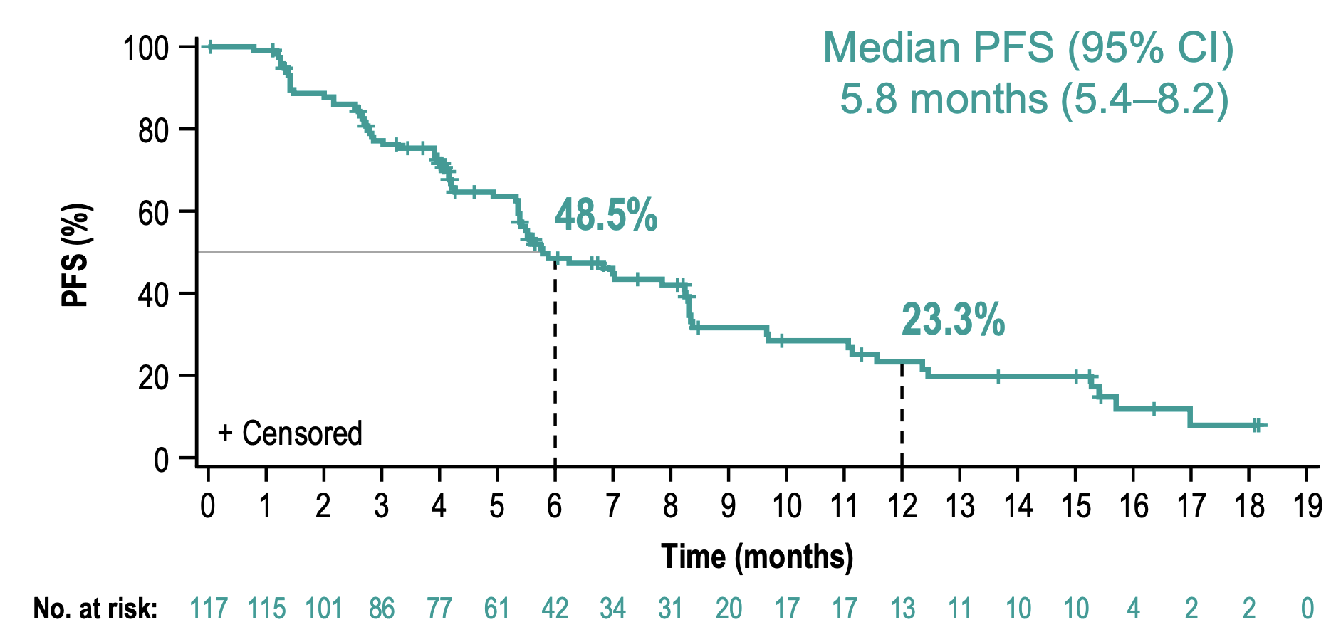
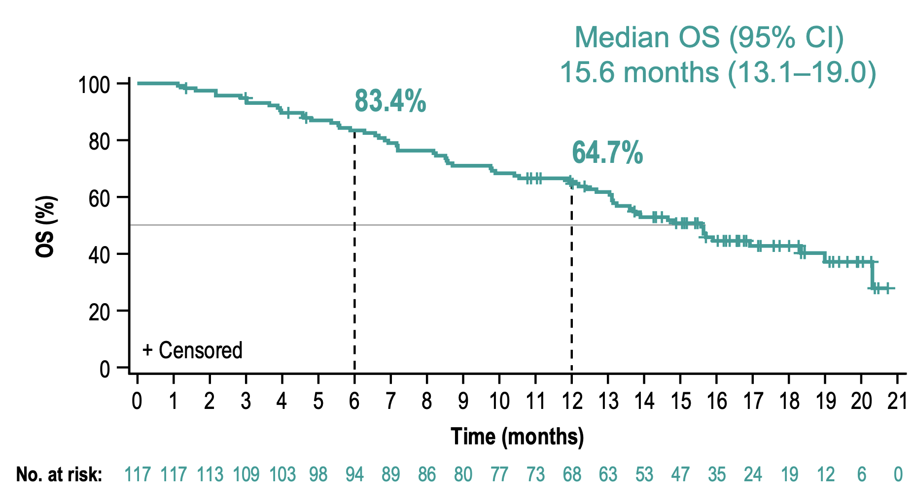
Pooled Analysis from TROPION-Lung01 and TROPION-Lung05: Efficacy
PFS
OS
Ahn MJ et al. ESMO Asia 2024;Abstract LBA7; Ahn MJ et al. J Thorac Oncol 2025;20(11):1669-82.

Slide 75
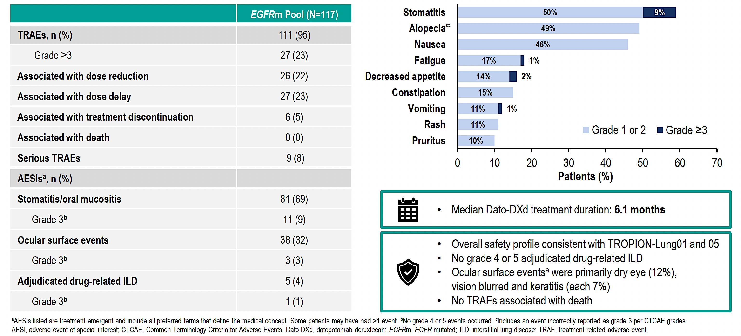
Pooled Analysis from TROPION-Lung01 and TROPION-Lung05: Safety
TRAEs Occurring in ≥10% of EGFRm Pool (N=117)
Ahn MJ et al. ESMO Asia 2024;Abstract LBA7; Ahn MJ et al. J Thorac Oncol 2025;20(11):1669-82.

Slide 76
Select Ongoing Phase III Trials of TROP2-Targeted ADCs for NSCLC
Trial identifier | N | Setting | Treatment arms | Key endpoints | Estimated completion date
TROPION-Lung14 (NCT06350097) | 582 | 1L EGFR-mutated NSCLC | Dato-DXd + osimertinib versus osimertinib | PFS, OS | 2031-08-29
TROPION-Lung15 (NCT06417814) | 744 | 2L EGFR-mutated NSCLC (progressed on prior osimertinib) | Dato-DXd + osimertinib versus Dato-DXd versus chemotherapy | PFS, OS | 2028-09-27
TROPION-Lung07 (NCT05555732) | 1,170 | 1L nonsquamous NSCLC (w/o AGA, PD-L1 <50%) | Dato-DXd + pembrolizumab + platinum versus Dato-DXd + pembrolizumab versus pembrolizumab + pemetrexed + platinum | PFS, OS | 2031-05-11
TROPION-Lung08 (NCT05215340) | 740 | 1L NSCLC (w/o AGA, PD-L1 ≥50%) | Dato-DXd + pembrolizumab versus pembrolizumab | PFS, OS | 2032-03-04
1L = first-line; AGA = actionable genomic alterations

Slide 77
Select Ongoing Phase III Trials of TROP2-Targeted ADCs for NSCLC
Trial identifier | N | Setting | Treatment arms | Key endpoints | Estimated completion date
AVANZAR (NCT05687266) | 1,350 | 1L nonsquamous NSCLC (w/o AGA) | Dato-DXd + durvalumab + carboplatin versus pembrolizumab + chemotherapy | PFS, OS | 2027-11-01
TROPION-Lung10 (NCT06357533) | 675 | 1L nonsquamous NSCLC (w/o AGA, PD-L1 ≥50%) | Dato-DXd + rilvegostomig versus rilvegostomig versus pembrolizumab | PFS, OS | 2029-12-28
TROPION-Lung17 (NCT07291037) | 400 | 2L TROP2 NMR-positive nonsquamous NSCLC | Dato-DXd versus docetaxel | PFS, OS | 2029-01-29
2L = second-line; NMR = normalized membrane ratio

Slide 78
Phase III SAFFRON Trial: Savolitinib and Osimertinib versus Chemotherapy for EGFR-Mutant NSCLC with MET Overexpression or Amplification After Treatment with Osimertinib
Locally advanced or metastatic NSCLC
EGFRm (Ex19del/L858R) and/or T790M, and MET overexpression and/or amplification
Disease progression on first- or second-line treatment with osimertinib
No prior chemotherapy in the metastatic setting allowed
ECOG PS 0-1
Savolitinib (300 mg BID) +
osimertinib (80 mg QD)
Primary endpoint:
PFS by blinded independent central review
Key secondary endpoints:
OS (overall population and for patients with MET overexpression), PFS for patients with MET overexpression, ORR, DoR, pharmacokinetics, and safety
N = 324
1:1
Pemetrexed (500 mg/m²) +
carboplatin (AUC5) or cisplatin (75 mg/m²), Q3W x 4 cycles →
maintenance pemetrexed (500 mg/m²), Q3W
Stratification factors: line of therapy (second/third line), baseline brain metastases (yes/no) and race (Asian/non-Asian)
Lu S et al. WCLC 2022;Abstract EP08.02; www.clinicaltrials.gov. NCT05261399. Accessed August 2026.

Slide 79
Osimertinib and Savolitinib Demonstrated Statistically Significant and Clinically Meaningful Improvements in PFS and OS for MET-Driven EGFR-Mutated Lung Cancer After Disease Progression on Osimertinib
Press Release: August 17, 2026
“Positive high-level results from the SAFFRON Phase III trial showed osimertinib plus savolitinib demonstrated a statistically significant and clinically meaningful improvement in both progression-free survival (PFS) and overall survival (OS) versus doublet platinum-based chemotherapy in patients with epidermal growth factor receptor-mutated (EGFRm) non-small cell lung cancer (NSCLC). Patients in the trial had tumours with high levels of MET overexpression or amplification and had progressed on prior treatment with osimertinib.
The safety profile for osimertinib plus savolitinib was consistent with the known profiles of each medicine, and there were no new safety findings.”
https://www.astrazeneca.com/media-centre/press-releases/2026/tagrisso-orpathys-improved-pfs-os-egfrm-lung.html.

Slide 80
Cases and Discussion Questions
66-year-old man with no history of tobacco use who presented with several weeks of cough and dyspnea is diagnosed with metastatic NSCLC with an EGFR exon 20 insertion mutation and PD-L1 TPS 0%. Minimal disease burden and symptoms. Brain MRI is negative.
Jennifer Yanucci, MD
How do you currently think through selection/sequencing of therapies for NSCLC with exon 20 insertion mutations, and how might this change in the near future? If amivantamab/chemotherapy, sunvozertinib monotherapy and zipalertinib/chemotherapy were all available as first-line therapy, how would you choose among them?

Slide 81
Cases and Discussion Questions (Continued)
If this patient received first-line amivantamab/chemotherapy and experienced disease progression, what would be your preferred second-line therapy? What would it be if you had access to both sunvozertinib and zipalertinib in the relapsed setting?
How do amivantamab, sunvozertinib and zipalertinib differ in terms of tolerability profile? What are the most common AEs with each one?

Slide 82
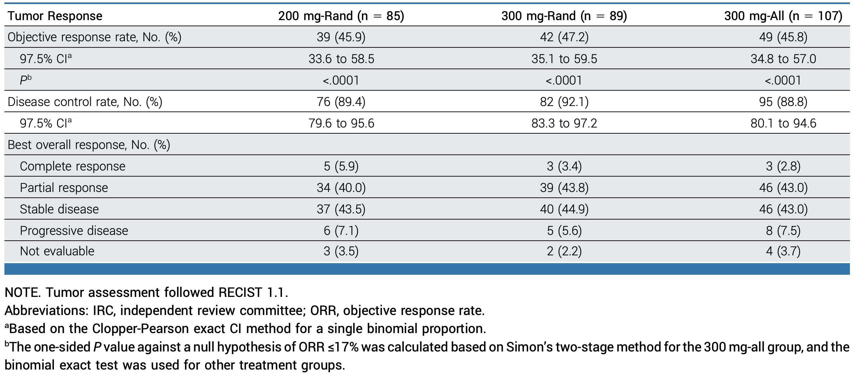
WU-KONG1B Trial: Sunvozertinib for Platinum-Pretreated NSCLC with EGFR Exon 20 Insertion Mutations
Yang JC et al. J Clin Oncol 2025;43(29):3198-208.

Slide 83
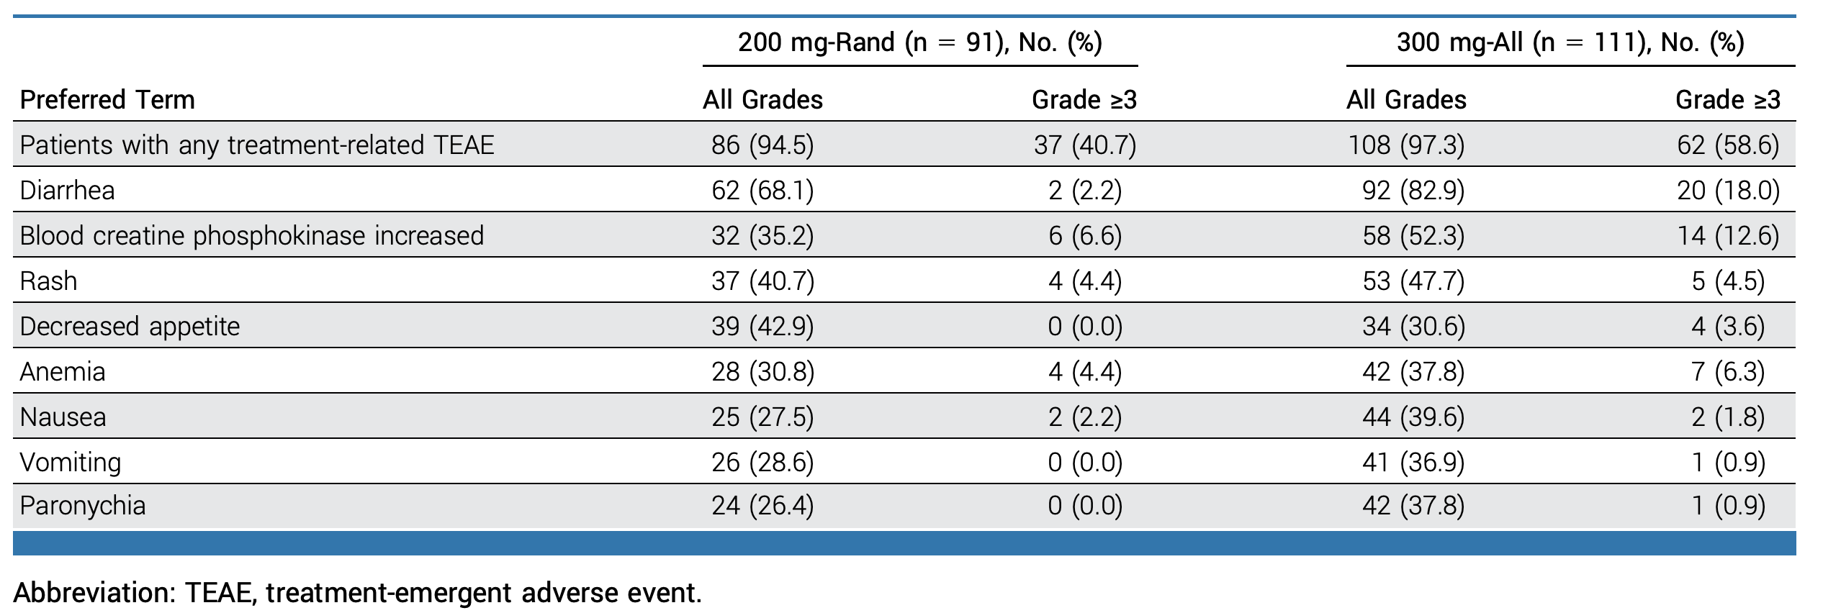
WU-KONG1B: Safety
The Most Common (≥30%) Treatment-Related Adverse Events
Yang JC et al. J Clin Oncol 2025;43(29):3198-208.

Slide 84
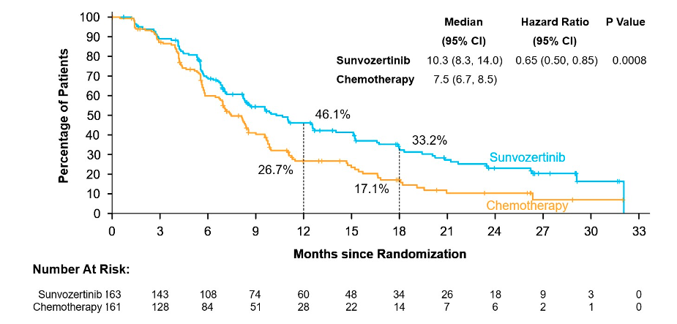
WU-KONG28 Trial: First-Line Sunvozertinib versus Platinum-Based Chemotherapy for NSCLC with EGFR Exon 20 Insertion Mutations
PFS
Median follow-up time: 24.0 months in the sunvozertinib arm and 18.0 months in the chemotherapy arm.
Heymach JV et al. ASCO 2026;Abstract LBA8500. Zhou C et al. N Engl J Med 2026;[Online ahead of print].

Slide 85
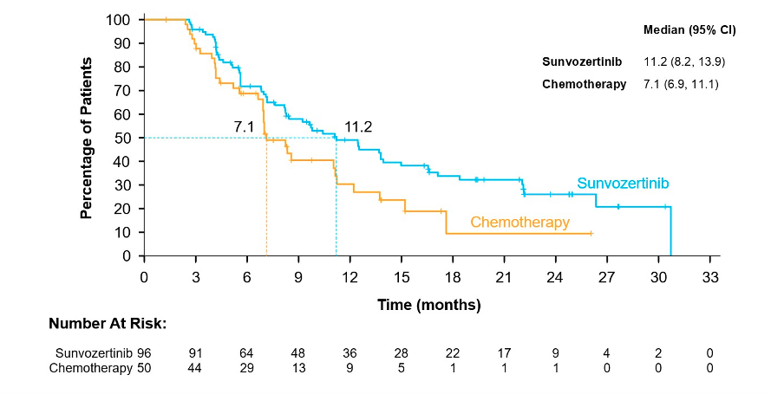
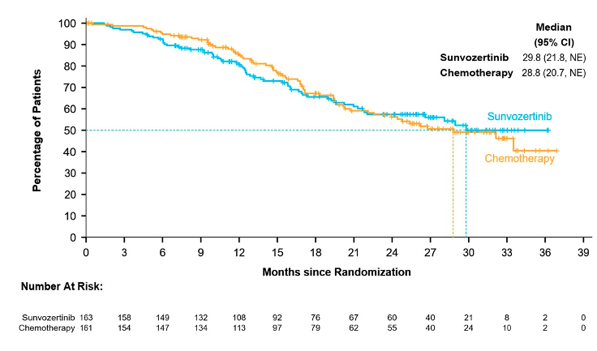
WU-KONG28: DOR and OS
DoR
Interim OS (38.9% maturity)
Median follow-up time: 22.1 months in the sunvozertinib arm and 13.8 months in the chemotherapy arm.
Median follow-up time: 26.1 months in the sunvozertinib arm and 26.7 months in the chemotherapy arm.
Heymach JV et al. ASCO 2026;Abstract LBA8500. Zhou C et al. N Engl J Med 2026;[Online ahead of print].

Slide 86
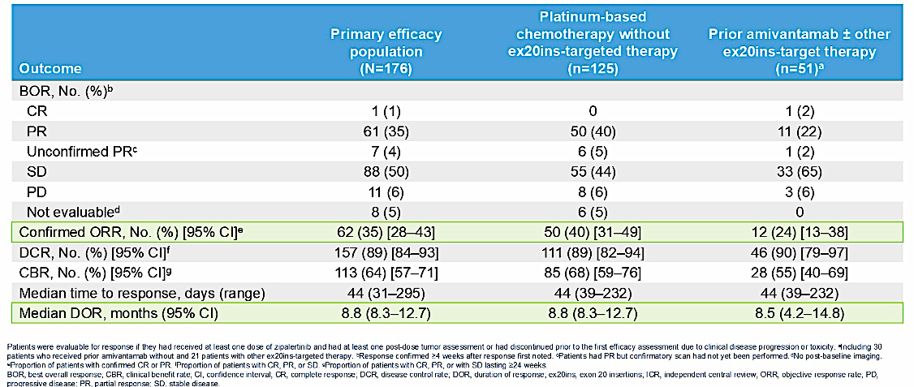
REZILIENT1 Study: Zipalertinib for NSCLC with EGFR Exon 20 Insertion Mutations in Patients Who Received Prior Platinum-Based Chemotherapy with or without Amivantamab
Yu HA et al. ASCO 2025;Abstract 8503. Piotrowska Z et al. J Clin Oncol 43(21):2387-97.

Slide 87
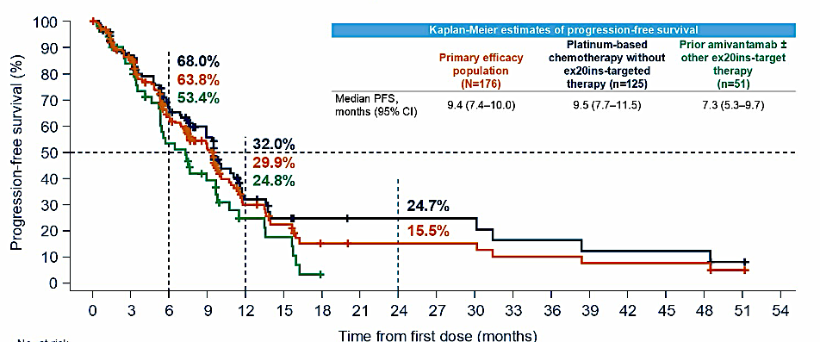
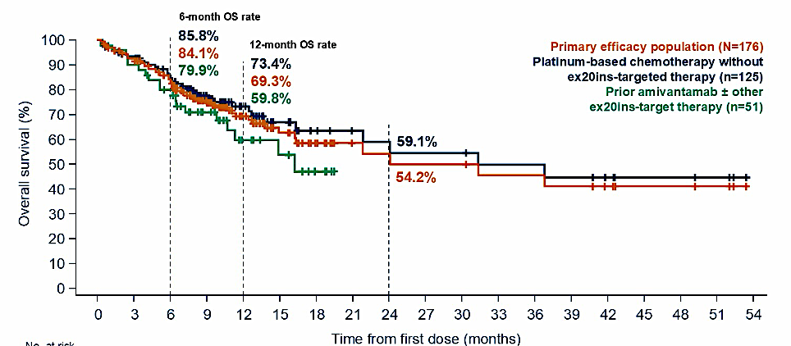
REZILIENT1: PFS and OS
PFS
OS
Yu HA et al. ASCO 2025;Abstract 8503. Piotrowska Z et al. J Clin Oncol 43(21):2387-97.

Slide 88
Zipalertinib and Chemotherapy Meets Primary Endpoint of PFS in a Planned Interim Analysis of the Phase III REZILIENT3 Trial for Untreated NSCLC with EGFR Exon 20 Insertion Mutations
Press Release: August 12, 2026
“The REZILIENT3 trial, a global Phase 3 clinical trial evaluating the combination of zipalertinib and platinum-based chemotherapy compared with chemotherapy alone in the first-line treatment of adult patients with previously untreated, locally advanced or metastatic non-small cell lung cancer (NSCLC) harboring epidermal growth factor receptor (EGFR) exon 20 insertion (ex20ins) mutations, met its primary endpoint of progression-free survival (PFS) at a planned interim analysis.
In this analysis, the study demonstrated a statistically significant and clinically meaningful improvement in PFS in the zipalertinib containing arm. Observed safety for the zipalertinib containing arm was manageable. Based on these data, the Independent Data Monitoring Committee recommended unblinding the study. The trial will continue to monitor efficacy and safety.”
https://www.taihooncology.com/us/news/zipalertinib-plus-chemotherapy-meets-primary-endpoint-of-progression-free-survival-in-planned-interim-analysis-of-phase-3-rezilient3-trial-in-first-line-egfr-exon-20-insertion-mutation-non-small-cell-lung-cancer/

Slide 89
Agenda
Module 5 — Lung Cancer: Dr Liu
EGFR Mutations
HER2 Alterations
ALK Fusions
Available and Investigational Immunotherapies
Small Cell Lung Cancer

Slide 90
Cases and Discussion Questions
76-year-old “Senior Olympics athlete” with metastatic NSCLC with a HER2 TKD mutation. Received initial therapy with carboplatin, pemetrexed and pembrolizumab, then T-DXd with response followed by progression. Started on zongertinib with significant diarrhea and rash, 30% to 40% reduction in disease volume.
Stephen “Fred” Divers, MD
What is the optimal first-line therapy for patients with metastatic NSCLC and a HER2 TKD mutation? If zongertinib, sevabertinib and trastuzumab deruxtecan
(T-DXd) were all equally accessible in the front-line setting — which it looks like they may soon be — how would you choose among them?

Slide 91
Cases and Discussion Questions (Continued)
How would you indirectly compare the tolerability of zongertinib, sevabertinib and T-DXd? What are the most common toxicities with these agents?
What is the optimal second-line therapy for patients with HER2 TKD mutations and disease progression on first-line zongertinib? What second-line therapy would you choose after disease progression on first-line T-DXd or sevabertinib, assuming those agents move into the front-line setting?
Would you be comfortable using T-DXd for a patient with a history of interstitial lung disease, perhaps from prior thoracic radiation therapy?

Slide 92
Cases and Discussion Questions (Continued)
How do you sequence T-DXd for patients with metastatic NSCLC and HER2 overexpression (IHC 3+)?
Would you employ T-DXd for a patient with HER2 IHC 2+ or IHC 1+ disease?
How common is co-occurring HER2 mutation and HER2 overexpression? What do you do in these cases?

Slide 93

Targeting HER2 in NSCLC
Activating ERBB2 Mutations
HER2 Overexpression (IHC 3+)
ERBB2 Amplification
TKD-activating mutations:
TKIs including zongertinib for any line and sevabertinib approved for ≥2L
Activating mutations:
T-DXd approved for ≥2L setting
T-DXd approved for patients with unresectable or metastatic HER2-positive (IHC 3+) solid tumors who have received prior systemic treatment (tumor agnostic)
No approved therapies specifically for ERBB2 amplification
TKI = tyrosine kinase inhibitor

Slide 94
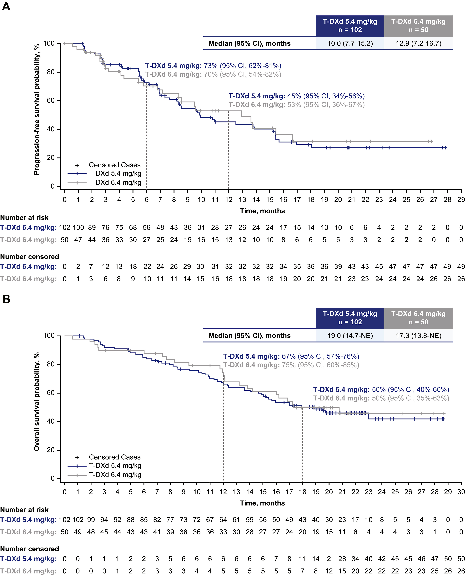
DESTINY-Lung02 Study: Trastuzumab Deruxtecan for HER2-Mutated NSCLC in the Second Line and Beyond
PFS
OS
Jänne PA et al. J Thorac Oncol 2025;20(12):1814-28.

Slide 95
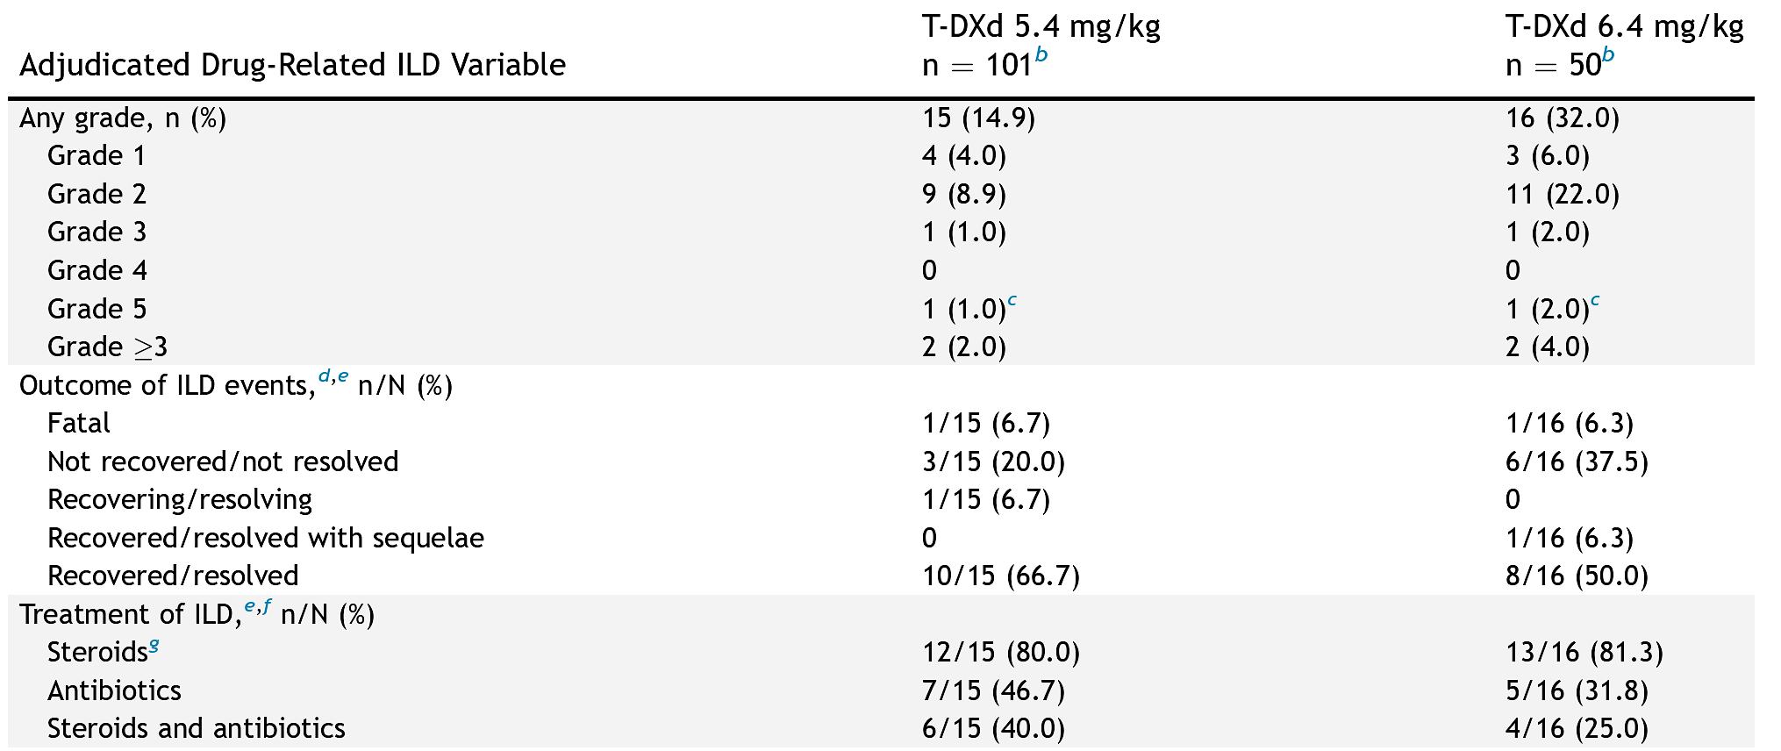
Adjudicated Drug-Related Interstitial Lung Disease (ILD)
Jänne PA et al. J Thorac Oncol 2025;20(12):1814-28.

Slide 96
Trastuzumab Deruxtecan Demonstrated Statistically Significant and Clinically Meaningful Improvement in PFS as First-Line Treatment for HER2-Mutant Advanced NSCLC in the DESTINY-Lung04 Phase III Trial
Press Release: August 17, 2026
“Positive high-level results from the DESTINY-Lung04 Phase III trial showed trastuzumab deruxtecan demonstrated a statistically significant and clinically meaningful improvement in progression-free survival (PFS) versus global standard of care (platinum-pemetrexed doublet chemotherapy plus pembrolizumab) as 1st-line treatment of patients with unresectable, locally advanced or metastatic HER2-mutant non-squamous non-small cell lung cancer (NSCLC).
The safety profile of trastuzumab deruxtecan observed in DESTINY-Lung04 was generally consistent with its known profile, with no new safety concerns identified.”
https://www.astrazeneca.com/media-centre/press-releases/2026/enhertu-improved-pfs-in-1l-her2m-lung-cancer.html.

Slide 97
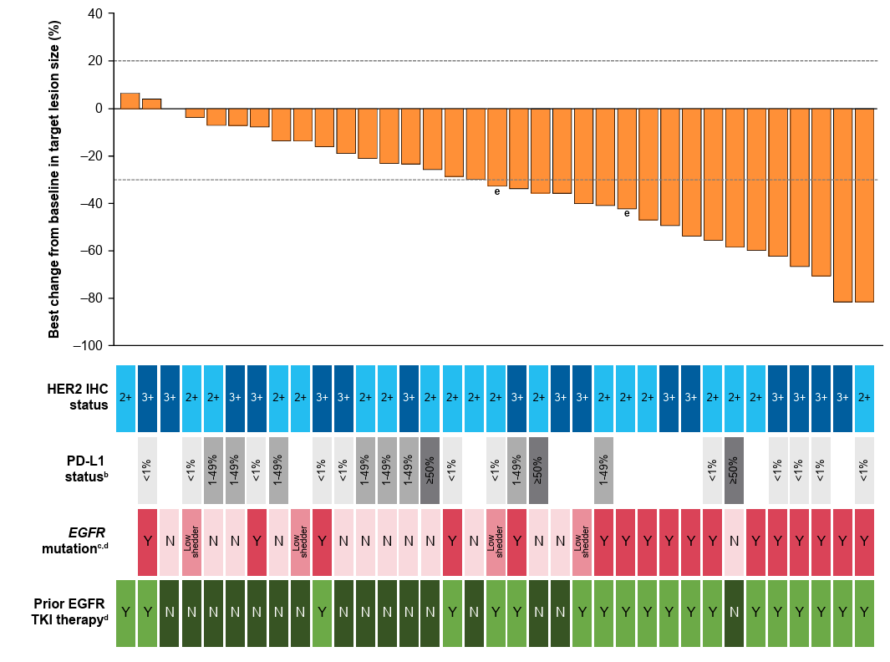
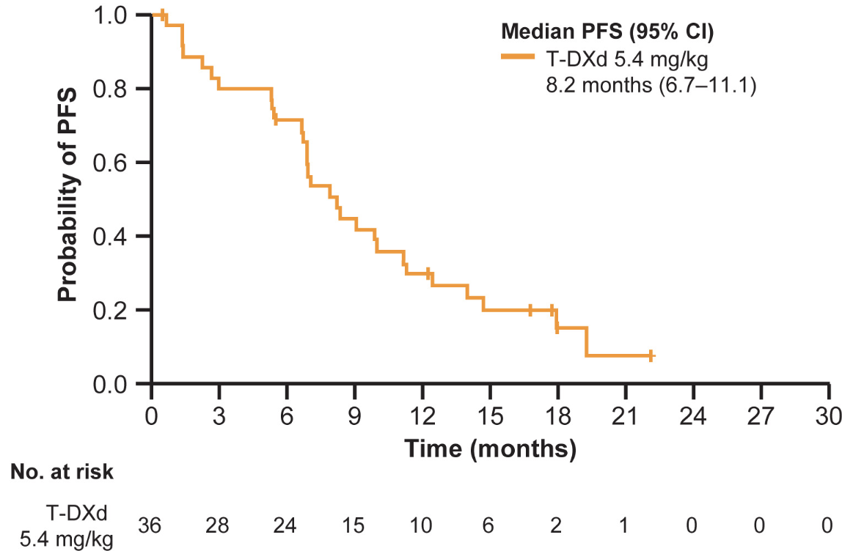
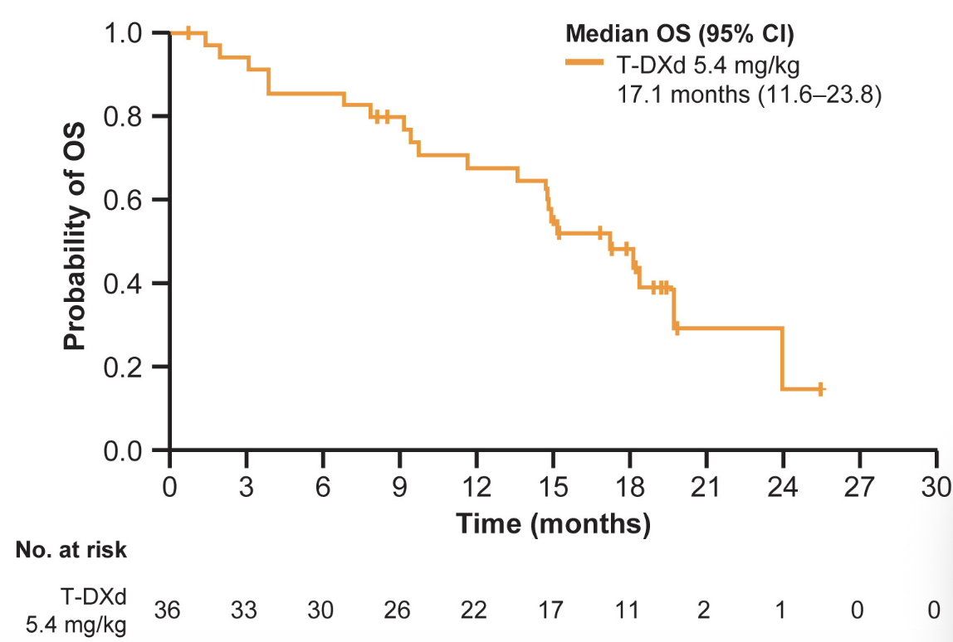
DESTINY-Lung03 Study: T-DXd for HER2-Overexpressing NSCLC
Confirmed ORR: 44.4%; Median DOR: 11.0 months;
Median PFS: 8.2 months
PFS
OS
ORR = objective response rate
Planchard D et al. J Thorac Oncol 2026;21(5):103541.

Slide 98
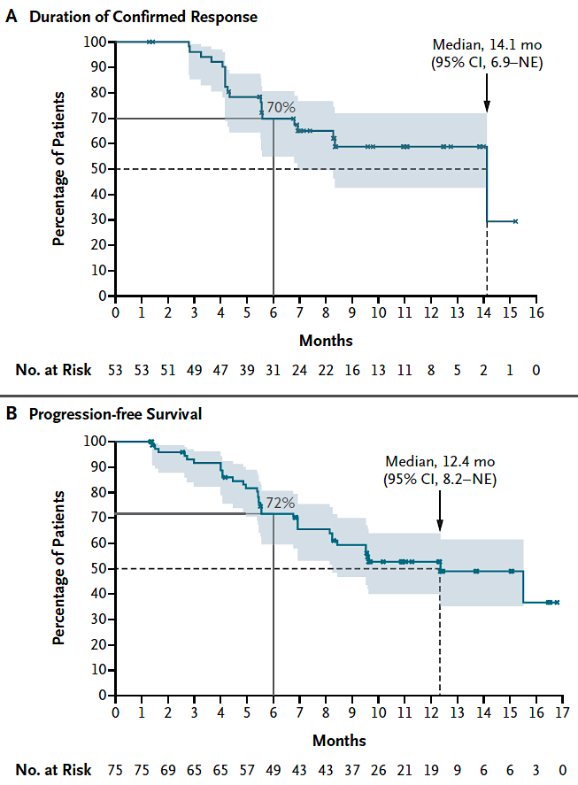
Beamion LUNG-1 Study: Zongertinib for Previously Treated HER2-Mutated NSCLC
Zongertinib: HER2-specific, EGFR-sparing TKI
Heymach JV et al. N Engl J Med 2025;392:2321-33.

Slide 99
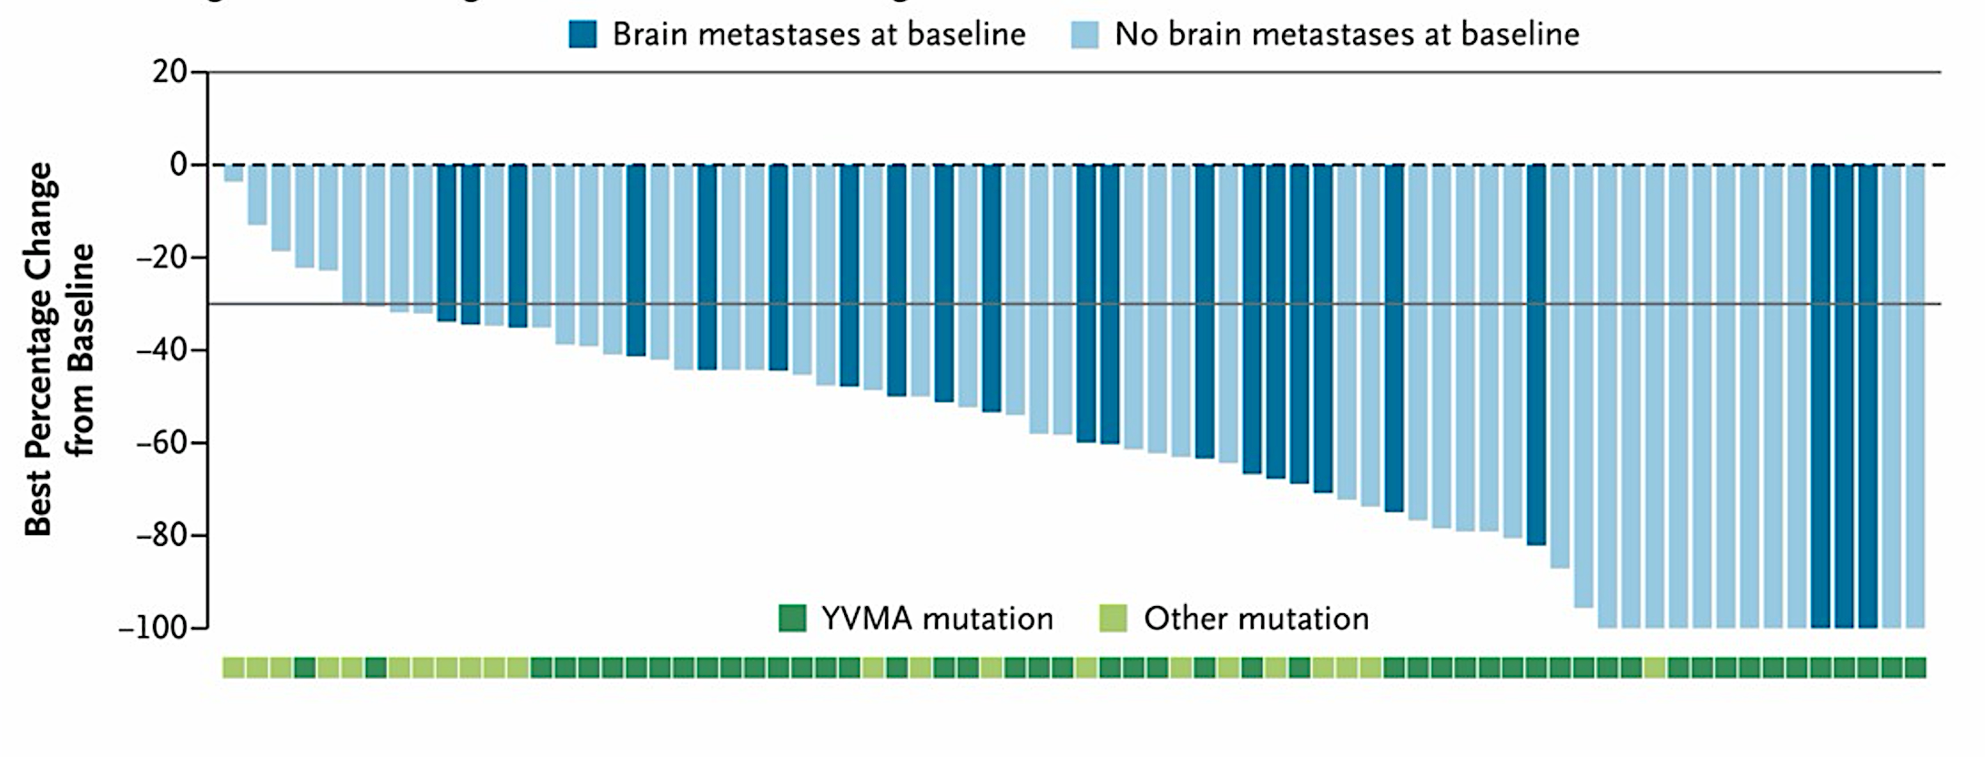
Beamion LUNG-1: Zongertinib for Treatment-Naïve HER2-Mutated NSCLC
Confirmed response
by BICR (RECIST v1.1)
Cohort 2:
Treatment-naïve patients
N = 74
ORR | 76%
CR, n (%) | 8 (11)
PR, n (%) | 48 (65)
DCR | 96%
SD, n (%) | 15 (20)
PD, n (%) | 1 (1)*
Median time to objective response was
1.4 months (95% CI, 1.1 to 6.9)
ORR = objective response rate
Heymach JV et al. N Engl J Med 2026;394(17):1675-84. Heymach JV et al. ELCC 2026;Abstract 6MO.

Slide 100
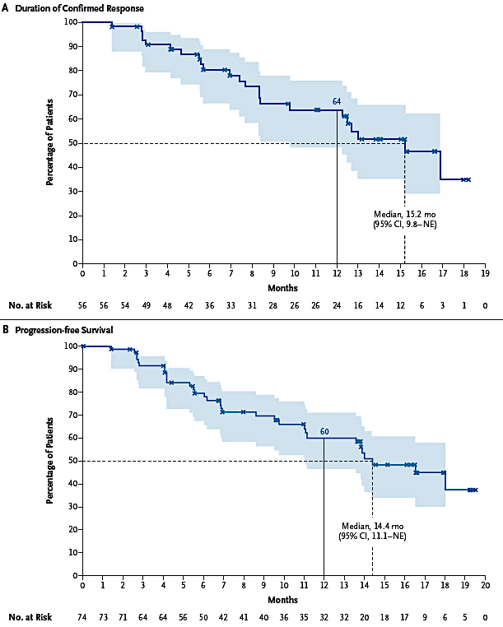
Beamion LUNG-1: Zongertinib for Treatment-Naïve HER2-Mutated NSCLC (Continued)
PFS
DoR
Heymach JV et al. N Engl J Med 2026;394(17):1675-84. Heymach JV et al. ELCC 2026;Abstract 6MO.

Slide 101

Zongertinib for Treatment-Naïve HER2-Mutated NSCLC: Safety Profile
Heymach JV et al. N Engl J Med 2026;394(17):1675-84. Heymach JV et al. ELCC 2026;Abstract 6MO.

Slide 102

SOHO-01 Trial Cohorts D, F: Sevabertinib for Treatment-Naïve and Previously Treated HER2-Mutated NSCLC
Sevabertinib: Reversible TKI
Cohort D: Patients previously treated with systemic therapy but naïve to HER2 ex20ins-targeted therapy
Cohort F: Patients naïve to systemic treatment for locally advanced or metastatic disease
ORR = overall response rate
Loong HH et al. ASCO 2026;Abstract 8622.

Slide 103


SOHO-01 Cohorts D, F: Sevabertinib for Treatment-Naïve and
Previously Treated HER2-Mutated NSCLC
Cohort D
Cohort F
PFS
DoR
Loong HH et al. ASCO 2026;Abstract 8622.

Slide 104
Select Ongoing Phase III Trials of HER2-Targeted Therapy for NSCLC
Trial identifier | N | Setting | Treatment arms | Key endpoints | Estimated completion date
DESTINY-Lung06 (NCT06899126) | 686 | 1L HER2-overexpressing, PD-L1 TPS <50% NSCLC | T-DXd + pembrolizumab versus pembrolizumab + chemotherapy | PFS, OS | 2032-11-24
Beamion LUNG-2 (NCT06151574) | 428 | 1L nonsquamous NSCLC with HER2 TKD mutations | Zongertinib versus standard Tx | PFS, OS | 2028-01-28
Beamion LUNG-3 (NCT07195695) | 400 | Adjuvant; Resectable, Stage II-IIIB HER2-mutated NSCLC | Zongertinib versus standard Tx | DFS, OS | 2036-09-02
SOHO-02 (NCT06452277) | 444 | 1L HER2-mutated NSCLC | Sevabertinib versus standard Tx | PFS, OS | 2029-06-27
TPS = tumor proportion score

Slide 105
Agenda
Module 5 — Lung Cancer: Dr Liu
EGFR Mutations
HER2 Alterations
ALK Fusions
Available and Investigational Immunotherapies
Small Cell Lung Cancer

Slide 106
Cases and Discussion Questions
45-year-old never smoker presents with metastatic lung adenocarcinoma and multiple asymptomatic brain metastases, the largest measuring 1.2 cm. NGS demonstrates an EML4-ALK fusion. ECOG PS is 0.
Sunil Babu, MD
In general, what is your preferred first-line treatment for metastatic NSCLC with an ALK fusion?
Which ALK inhibitor would you choose in the first line for this patient with baseline CNS disease?
When can highly CNS-active systemic therapy allow you to defer brain radiation?

Slide 107
Cases and Discussion Questions
I have a patient right now who has Stage III unresectable disease, is getting chemoradiation and has an ALK gene rearrangement.
Brian P Mulherin, MD
In patients with unresectable locally advanced NSCLC, for which actionable genomic alterations do you (or would you like to) recommend targeted treatment rather than durvalumab consolidation after chemoradiation therapy?

Slide 108



Targeting ALK in NSCLC
Treatment-emergent drug-resistant ALK mutations
Brain metastases
TRK-related neurologic AEs
Lin J et al. Cancer Discov 2024;14(12):2367-86.

Slide 109

ALKOVE-1: Efficacy of Neladalkib for ALK TKI-Naïve Disease
Lin JJ et al. ASCO 2026;Abstract 8503.

Slide 110
Agenda
Module 5 — Lung Cancer: Dr Liu
EGFR Mutations
HER2 Alterations
ALK Fusions
Available and Investigational Immunotherapies
Small Cell Lung Cancer

Slide 111
Cases and Discussion Questions
69 y/o woman who presented with SOB, anorexia with a 20-lb weight loss and cough. Imaging showed a 3.4-cm RUL nodule, bulky ipsilateral hilar and mediastinal LAD, 3 liver metastases, a right adrenal metastasis, innumerable bone metastases and 2 asymptomatic cerebellar metastases. Bx confirmed squamous cell carcinoma of the lung, PD-L1 TPS 20%. Tissue- and blood-based NGS showed no actionable genomic alterations. ECOG PS 1.
Brian P Mulherin, MD
If this patient were to ask you the chances that she would be alive and free of progressive disease with first-line pembrolizumab/chemotherapy after 1 year, how would you respond? What about after 3 years? 5 years?

Slide 112
Cases and Discussion Questions (Continued)
Do you believe immune checkpoint bispecific antibodies will replace anti-PD-1/PD-L1 antibodies as first-line treatment? Which immune checkpoint bispecific antibodies (PD-1 x VEGF, PD-1 x TIGIT), if any, are you particularly enthusiastic about?
This patient has been researching and says, “I’ve read about a drug that’s approved in China and is more effective than what I can currently receive. Will this be available here anytime soon? If it were, would you recommend it?” How would you respond?

Slide 113


Ivonescimab: PD-1 x VEGF Bispecific Antibody
Zhang L et al. ASCO 2024;Abstract 8508.

Slide 114


HARMONi-6 Trial: First-Line Ivonescimab with Chemotherapy versus Tislelizumab with Chemotherapy for Squamous NSCLC
PFS
OS
Lu S et al. ESMO 2025;Abstract LBA4. Lu S et al. Lancet 2026;407(10548):2620-9.

Slide 115


HARMONi-2 Study: First-Line Ivonescimab versus Pembrolizumab for PD-L1-Positive NSCLC
ORR and DCR
PFS
ORR = objective response rate
Zhou C et al. WCLC 2024;Abstract PL02.04. Xiong A et al. Lancet 2025;405(10481):839-49.

Slide 116



HARMONi Trial: Ivonescimab with Chemotherapy for
EGFR-Mutated NSCLC After EGFR TKI
Goldman J et al. WCLC 2025;Abstract PL02.12.

Slide 117

Pumitamig: A PD-L1 x VEGF-A Bispecific Antibody
MoA
Peters S et al. ASCO 2026;Abstract 8513.

Slide 118

ROSETTA Lung-02: A Phase II/III Trial of First-Line Pumitamig and Chemotherapy for NSCLC
Efficacy
uORR = unconfirmed objective response rate; NSQ = nonsquamous
Peters S et al. ASCO 2026;Abstract 8513.

Slide 119



ARTEMIDE-01 Trial: Rilvegostomig for Checkpoint Inhibitor-Naïve NSCLC
ORR and DoR
ORR = objective response rate
Cho BC et al. ESMO 2025;Abstract 1853MO.

Slide 120

ARTEMIDE-01: PFS
PFS
Cho BC et al. ESMO 2025;Abstract 1853MO.

Slide 121
Select Ongoing Phase III Trials of Bispecific Therapy for NSCLC
Trial identifier | N | Setting | Treatment arms | Key endpoints | Estimated completion date
HARMONi-3 (NCT05899608) | 1,600 | 1L metastatic NSCLC | Ivonescimab + chemotherapy versus pembrolizumab + chemotherapy | PFS, OS | 2029-12-31
HARMONi-7 (NCT06767514) | 780 | 1L metastatic NSCLC with high PD-L1 expression (≥50%) | Ivonescimab versus pembrolizumab | PFS, OS | 2029-06
ARTEMIDE-Lung02 (NCT06692738) | 1,160 | 1L metastatic squamous NSCLC with PD-L1 expression (≥1%) | Rilvegostomig + chemotherapy versus pembrolizumab + chemotherapy | PFS, OS | 2030-07-01
ARTEMIDE-Lung03 (NCT06627647) | 1,160 | 1L metastatic nonsquamous NSCLC with PD-L1 expression (≥1%) | Rilvegostomig + chemotherapy versus pembrolizumab + chemotherapy | PFS, OS | 2030-11-18
ARTEMIDE-Lung04 (NCT06868277) | 830 | 1L metastatic NSCLC with high PD-L1 expression (≥50%) | Rilvegostomig versus pembrolizumab | PFS, OS | 2030-12-02

Slide 122
Agenda
Module 5 — Lung Cancer: Dr Liu
EGFR Mutations
HER2 Alterations
ALK Fusions
Available and Investigational Immunotherapies
Small Cell Lung Cancer

Slide 123
Cases and Discussion Questions
70-year-old woman, a former smoker with a PMH of breast cancer, develops extensive-stage SCLC and receives cisplatin/etoposide/durvalumab.
Zanetta S Lamar, MD
How do you think through the use of maintenance lurbinectedin? Would you be comfortable administering it with durvalumab for a patient such as this one who already started on that agent?
When and for whom are you thinking about tarlatamab? Does tarlatamab have similar tolerability concerns to those with the bispecific antibodies that we use in other diseases, such as lymphoma and multiple myeloma?

Slide 124
Cases and Discussion Questions (Continued)
Based on available data, would you like to have access to ifinatamab deruxtecan (I-DXd) for your patients with ES-SCLC? If so, where would you envision using it opposite other available options?
What are the primary side effects associated with I-DXd? How do rates and severity of ILD compare to other DXd-based antibody-drug conjugates that we use in lung cancer?

Slide 125

Targeting B7-H3 in SCLC
B7 homologue 3 (B7-H3) is overexpressed in a wide range of cancer types and is associated with disease progression and lower overall survival.¹⁻⁵
1. Yamato M et al. AACR-NCI-EORTC 2020;Abstract 28. 2. Dong P et al. Front Oncol 2018;8:264. 3. Picarda E et al. Clin Cancer Res 2016;22(14):3425-31. 4. Bendell JC et al. J Clin Oncol 2020;39(15 suppl 1). Abstract TPS3646. 5. Kontos F et al. Clin Cancer Res 2021;27(5):1227-35. 6. Doi T et al. ESMO 2022;Abstract 4530.

Slide 126

IDeate-Lung01 Trial: Ifinatamab Deruxtecan (I-DXd) for ES-SCLC
Ahn MJ et al. WCLC 2025;Abstract OA06.03. Rudin CM et al. J Clin Oncol 2026;44(4):261-73.

Slide 127

IDeate-Lung01: ORR
Ahn MJ et al. WCLC 2025;Abstract OA06.03. Rudin CM et al. J Clin Oncol 2026;44(4):261-73.

Slide 128

IDeate-Lung01: PFS and OS
PFS
OS
Ahn MJ et al. WCLC 2025;Abstract OA06.03. Rudin CM et al. J Clin Oncol 2026;44(4):261-73

Slide 129

IDeate-Lung01: CNS Activity
In 29 patients with baseline brain target lesions, intracranial cORR was 65.5% (9 CR, 10 PR), and almost all patients experienced intracranial disease control (96.6%)
Rocha P et al. ESMO 2025;Abstract 2760MO.

Slide 130

IDeate-Lung01: Safety
Ahn MJ et al. WCLC 2025;Abstract OA06.03; Rudin CM et al. J Clin Oncol 2026;44(4):261-73.

Slide 131
Integrating New Advances into
Community Oncology Practice
A Multitumor Symposium Hosted in Conjunction with the American Oncology Network
CME/MOC, NCPD and ACPE Accredited
Saturday, August 22, 2026
9:00 AM – 2:20 PM CT

Slide 132
Thank you for joining us!
Your feedback is very important to us.
How to Obtain CME/MOC, NCPD and ACPE Credit
In-person attendees: Please refer to the program syllabus for the credit link or QR code.
Online/Zoom attendees: The credit link is posted in the chat room.

