Slide 1
Integrating New Advances into
Community Oncology Practice
A Multitumor Symposium Hosted in Conjunction with the American Oncology Network
CME/MOC, NCPD and ACPE Accredited
Saturday, August 22, 2026
9:00 AM – 2:20 PM CT

Slide 2

Welcome
AON Members!

Slide 3

MiBA (Meaningful Insights Biotech Analytics) is not your average data company.
MiBA is a healthcare AI technology company launched with a mission to close the feedback loop between physicians, patients, and industry partners. The CME program is sponsored with MiBA data insights, from AON practices.
MiBA has a clear vision to improve data quality by unlocking the power of data to fuel decisions, education and improve patient care.

Slide 4
Commercial Support
This activity is supported by educational grants from AbbVie Inc, Astellas, AstraZeneca Pharmaceuticals LP, BeOne, Corcept Therapeutics Inc, Daiichi Sankyo Inc, Genmab US Inc, Jazz Pharmaceuticals Inc, and Lilly.
Research To Practice CME Planning Committee Members,
Staff and Reviewers
Planners, scientific staff and independent reviewers for Research To Practice have no relevant financial relationships to disclose.

Slide 5
This educational activity contains discussion of
non-FDA-approved uses of agents and regimens. Please refer to official prescribing information for each product for approved indications.

Slide 6



Clinicians in the Meeting Room
Networked iPads are available.
Review Program Slides: Tap the Program Slides button to review speaker presentations and other program content.
Answer Survey Questions: Complete the 2 premeeting surveys.
Ask a Question: Tap Ask a Question to submit a challenging case or question for discussion. We will aim to address as many questions as possible during the program.
For assistance, please raise your hand. Devices will be collected at the conclusion of the activity.
Notes:
6

Slide 7

Clinicians Attending via Zoom
Review Program Slides: A link to the program slides will be posted in the chat room at the start of the program.
Answer Survey Questions: Complete the premeeting survey at the beginning of each module.
Ask a Question: Submit a challenging case or question for discussion using the Zoom chat room.
Get CME/NCPD/ACPE Credit: A credit link will be provided in the chat room at the conclusion of the program.
Notes:
7

Slide 8

About the Enduring Program
The live meeting is being video
and audio recorded.
The proceedings from today will
be edited and developed into
an enduring web-based program.
An email will be sent to all attendees
when the activity is available.
To learn more about our education programs, visit our website, www.ResearchToPractice.com
Notes:
8

Slide 9
Snapshot of AON Practice
Patients Seen in the Last 12 Months

Slide 10
Agenda
Module 1 — Chronic Lymphocytic Leukemia
Farrukh T Awan, MD, MS, MBA
Module 2 — Gastroesophageal Cancers
Samuel J Klempner, MD
Module 3 — Ovarian and Endometrial Cancer
Shannon N Westin, MD, MPH, FASCO, FACOG
Module 4 — Diffuse Large B-Cell Lymphoma
Ann LaCasce, MD, MMSc
Module 5 — Lung Cancer
Stephen V Liu, MD

Slide 11


Chronic Lymphocytic Leukemia Faculty
Farrukh T Awan, MD, MS, MBA
Professor of Internal Medicine
Associate Director, Section of Hematologic Malignancies/Transplantation and Cellular Therapies
Director of Lymphoid Malignancies Program
Harold C Simmons Comprehensive Cancer Center
University of Texas Southwestern Medical Center
Dallas, Texas
MODERATOR
Stephen “Fred” Divers, MD
Chief Medical Officer
American Oncology Network
Board Executive
Community Oncology Alliance
Hot Springs, Arkansas

Slide 12
Dr Awan — Disclosures
Consulting Agreements | AbbVie Inc, Adaptive Biotechnologies Corporation, AstraZeneca Pharmaceuticals LP, BeOne, Bristol Myers Squibb, DAVA Oncology, Genentech, a member of the Roche Group, Genmab US Inc, Incyte Corporation, Invivyd, Loxo Oncology Inc, a wholly owned subsidiary of Eli Lilly & Company, Miltenyi Biotec, Pierre Fabre
Contracted Research | Actinium Pharmaceuticals Inc, Pharmacyclics LLC, an AbbVie Company
Data and Safety Monitoring Boards/Committees | Ascentage Pharma, AstraZeneca Pharmaceuticals LP, Caribou Biosciences Inc

Slide 13
Dr Divers — Disclosures
Advisory Committees | Daiichi Sankyo Inc

Slide 14
Snapshot of AON Practice
CLL

Slide 15
Snapshot of AON Practice
CLL — Bruton Tyrosine Kinase Inhibitors (BTKi)

Slide 16
Snapshot of AON Practice
CLL — Other Treatments

Slide 17
Agenda
Module 1 — Chronic Lymphocytic Leukemia: Dr Awan
First-Line Therapy
Relapsed/Refractory Disease

Slide 18
Cases and Discussion Questions
56-year-old woman with IGHV-unmutated, del 13q CLL (90%). Initiated treatment with venetoclax/obinutuzumab + acalabrutinib at an academic center 3 months ago. Neutrophils dropped drastically due to obinutuzumab, treatment discontinued. Waiting for her to stabilize to restart treatment.
Brian P Mulherin, MD
What is your preferred initial treatment for an otherwise healthy patient with IGHV-unmutated CLL with no del(17p) or TP53 mutation? What about for a patient with IGHV-mutated disease? How does age influence this decision?

Slide 19
Cases and Discussion Questions (Continued)
How do you decide between fixed-duration regimens as initial treatment for CLL? When you opt for venetoclax/acalabrutinib, for which patients are you most likely to also include obinutuzumab?
Are you comfortable using zanubrutinib instead of acalabrutinib in combination with venetoclax?

Slide 20
Cases and Discussion Questions
76-year-old with atrial fibrillation on apixaban and del(17p) CLL. What treatment would you recommend for this patient?
Sunil Babu, MD
In general, what is your preferred initial treatment for an otherwise healthy patient with CLL and del(17p) or TP53 mutation? How, if at all, does age influence the decision? What about IGHV status?
If this patient expressed a strong preference for an up-front regimen with a defined stopping point, would you be comfortable employing a time-limited regimen? If so, which one?
Are you using MRD (minimal residual disease) to guide the duration of time-limited therapy? Are you more likely to do so for patients with high-risk features?

Slide 21
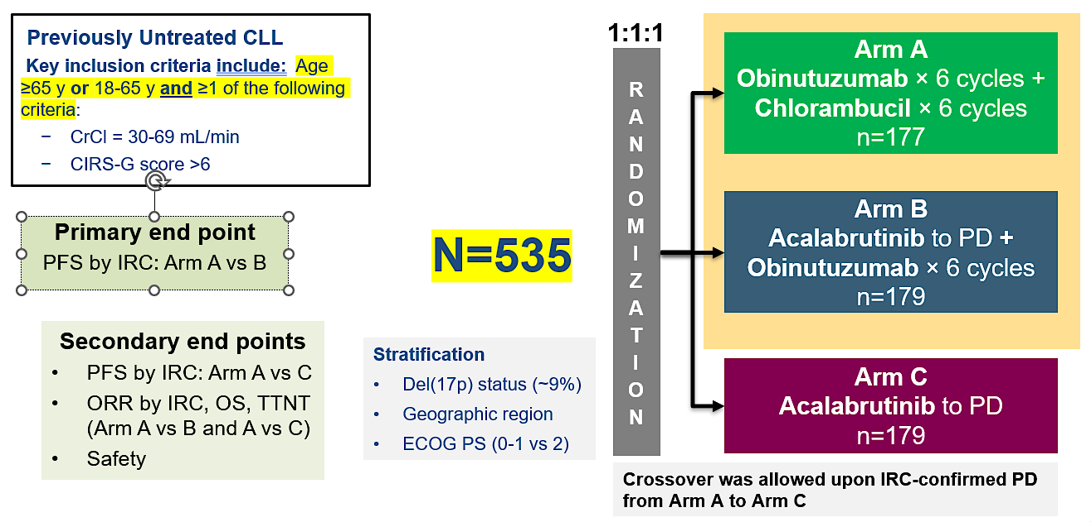
Phase III ELEVATE-TN Study Design
Primary end point
PFS by IRC: Arm A vs B
CLL = chronic lymphocytic leukemia; CrCl = creatinine clearance; CIRS-G = Cumulative Illness Rating Scale-Geriatric);
PFS = progression-free survival; IRC = independent review committee; ORR = overall response rate; OS = overall survival; TTNT = time to next treatment; PD = disease progression
Sharman JP et al. Blood 2025;146(11):1276-85; Lancet 2020;395(10232):1278-91.

Slide 22
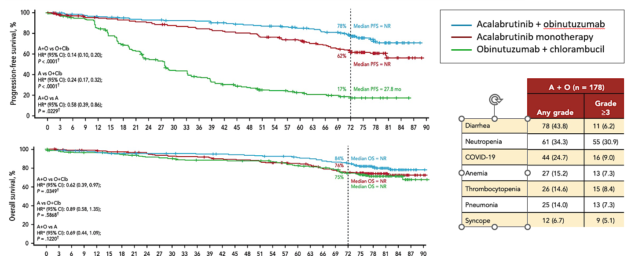
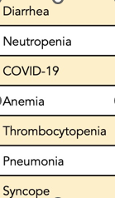
Phase III ELEVATE-TN: Efficacy (6-Year Follow-Up)
A = acalabrutinib; O = obinutuzumab; Clb = chlorambucil; NR = not reached
Sharman JP et al. Blood 2025;146(11):1276-85; Lancet 2020;395(10232):1278-91.

Slide 23
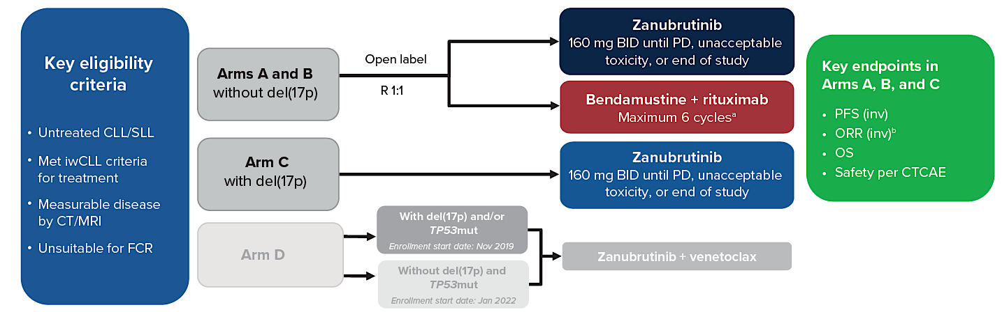
Phase III SEQUOIA Study Design
SLL = small lymphocytic leukemia; iwCLL = International Workshop on Chronic Lymphocytic Leukemia; FCR = fludarabine, cyclophosphamide, rituximab; ORR = overall response rate; CTCAE = Common Terminology Criteria for Adverse Events
Tam C et al. ASH 2025;Abstract 2129.

Slide 24
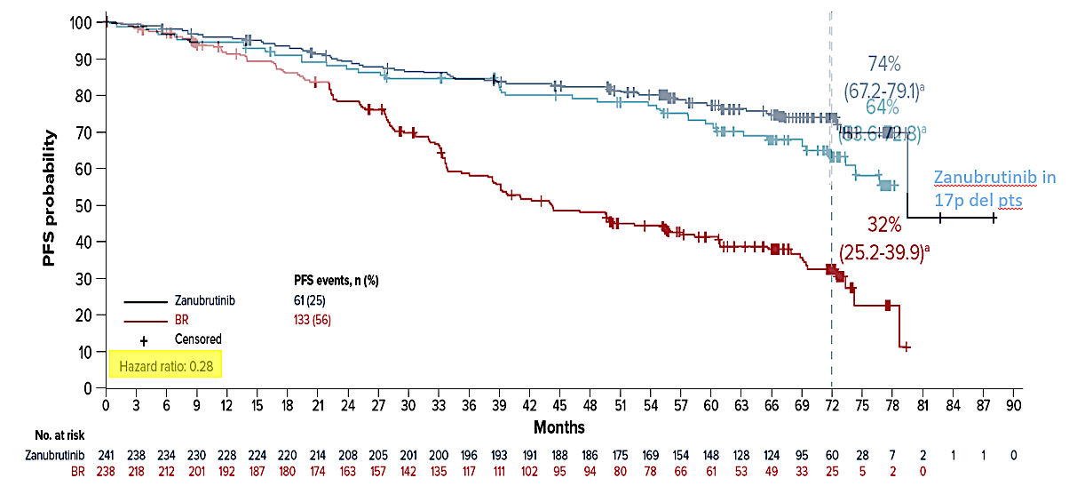
Phase III SEQUOIA: Efficacy (6-Year Follow-Up)
Tam C et al. ASH 2025;Abstract 2129.

Slide 25
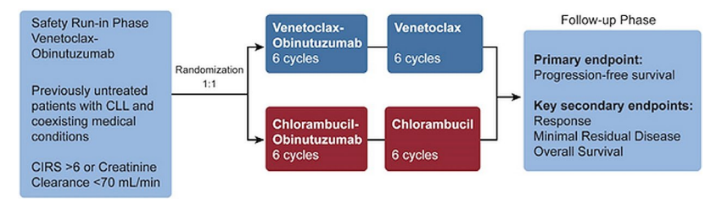
Phase III CLL14 Study: Fixed-Duration Venetoclax and Obinutuzumab versus Chlorambucil and Obinutuzumab in the First-Line Setting
CIRS = chronic inflammatory response syndrome
Dolan S et al. Curr Oncol 2020;27:e420-32.

Slide 26
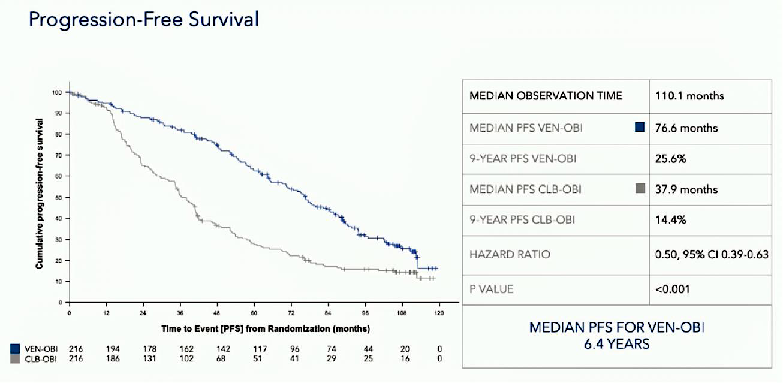
Phase III CLL14 Study: Fixed-Duration Venetoclax and Obinutuzumab versus Chlorambucil and Obinutuzumab in the First-Line Setting (Continued)
Fischer K et al. EHA 2026;Abstract S146.

Slide 27
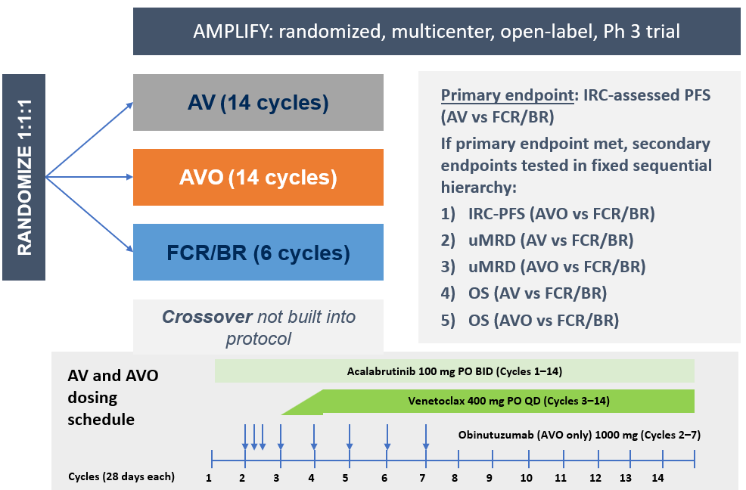
Phase III AMPLIFY Study: AV, AVO and FCR/BR in the First-Line Setting
AV = acalabrutinib/venetoclax; AVO = AV with obinutuzumab; BR = bendamustine/rituximab; uMRD = undetectable minimal residual disease
Brown JR et al. N Engl J Med 2025;392:748-62.

Slide 28
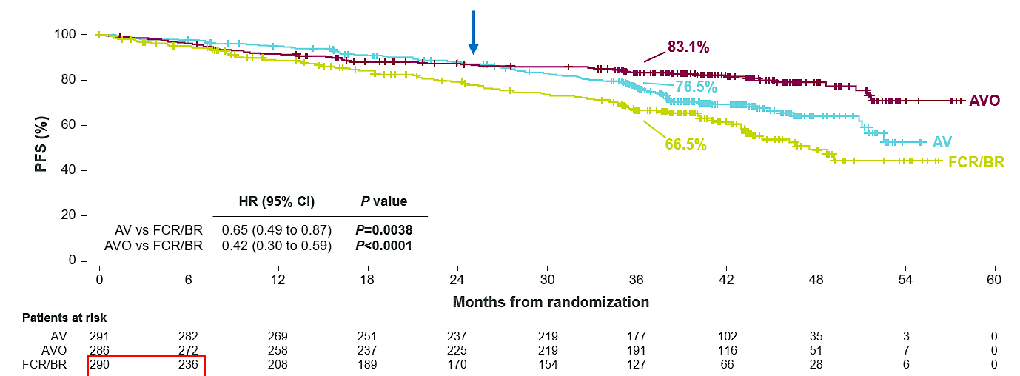
Phase III AMPLIFY Study: AV, AVO and FCR/BR in the First-Line Setting (Continued)
uIGHV = unmutated immunoglobulin heavy chain variable region genes
Benefit of AVO seen primarily in uIGHV:
HR (95% CI)
AV vs FCR/BR (mIGHV) 0.67 (0.39–1.14)
AVO vs FCR/BR (mIGHV) 0.58 (0.32–1.02)
HR (95% CI)
AV vs FCR/BR (uIGHV) 0.69 (0.48–0.97)
AVO vs FCR/BR (uIGHV) 0.35 (0.23–0.53)
Brown JR et al. N Engl J Med 2025;392:748-62.

Slide 29
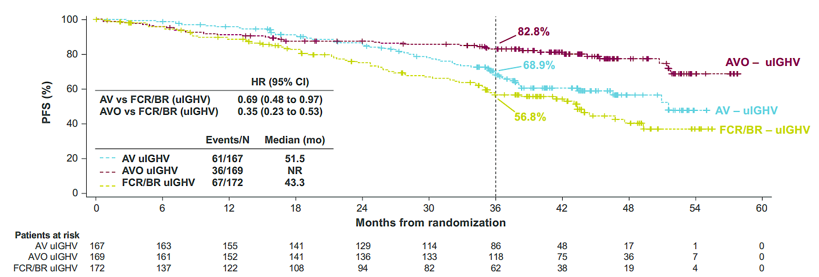
Phase III AMPLIFY Study: AV, AVO and FCR/BR in the First-Line Setting (Continued)
Brown JR et al. N Engl J Med 2025;392:748-62.

Slide 30
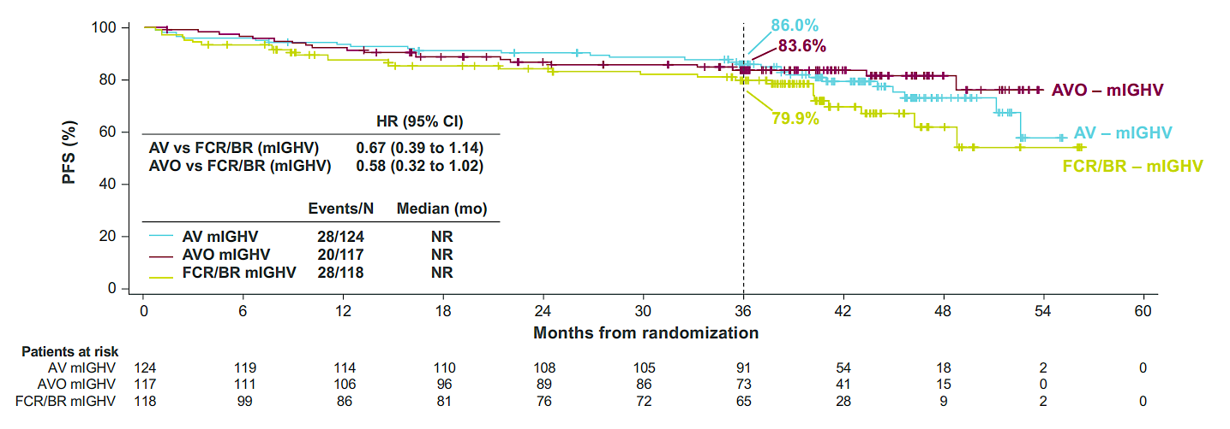
Phase III AMPLIFY Study: AV, AVO and FCR/BR in the First-Line Setting (Continued)
Brown JR et al. N Engl J Med 2025;392:748-62.

Slide 31
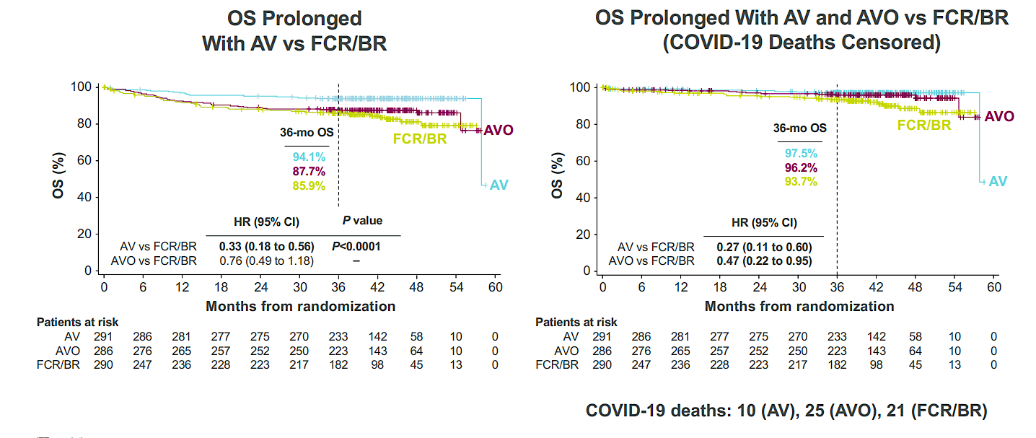
Phase III AMPLIFY Study: AV, AVO and FCR/BR in the First-Line Setting (Continued)
Brown JR et al. N Engl J Med 2025;392:748-62.

Slide 32
FDA Approves Acalabrutinib with Venetoclax for Chronic Lymphocytic Leukemia or Small Lymphocytic Lymphoma
Press Release: February 19, 2026
“On February 19, 2026, the Food and Drug Administration approved acalabrutinib tablets and capsules in combination with venetoclax for adults with chronic lymphocytic leukemia (CLL) or small lymphocytic lymphoma (SLL).
Efficacy was evaluated in AMPLIFY (NCT03836261), a randomized, multicenter trial in adult patients previously untreated for CLL without del(17p) or TP53 mutation. Patients were randomized to receive acalabrutinib and venetoclax (AV) or Investigator’s choice of chemotherapy (fludarabine plus cyclophosphamide plus rituximab [FCR] or bendamustine plus rituximab [BR]).
The major efficacy outcome measure was progression-free survival (PFS) as assessed by independent review committee for the AV arm versus the investigator’s choice arm (FCR/BR). The median duration of PFS follow-up was 42.6 months. Median PFS was not estimable (NE) (95% CI: 51.1, NE) in the AV arm and 47.6 months (95% CI: 43.3, NE) in the FCR/BR arm (Hazard ratio 0.65 [95% CI: 0.49, 0.87]; p-value 0.0038). With a median follow-up of 41.0 months, there were 18 (6%) deaths in the AV arm and 42 (14%) in the FCR/BR arm.”
https://www.fda.gov/drugs/resources-information-approved-drugs/fda-approves-acalabrutinib-venetoclax-chronic-lymphocytic-leukemia-or-small-lymphocytic-lymphoma

Slide 33
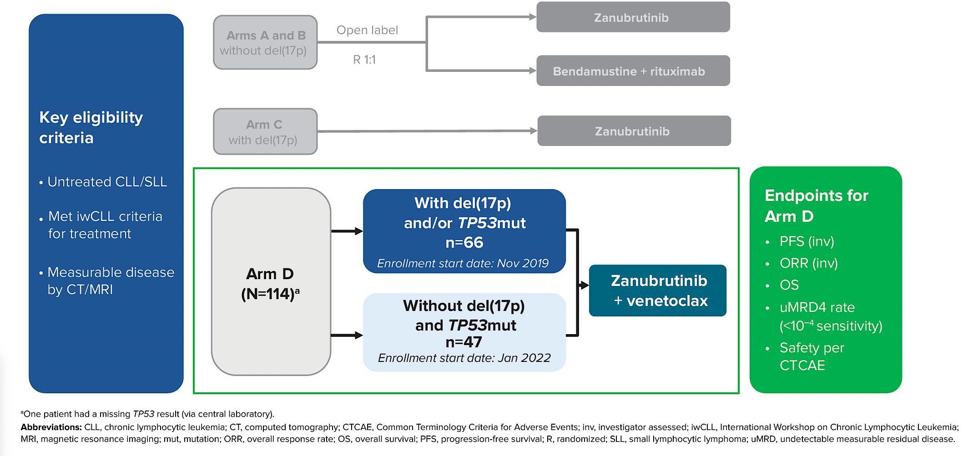
Phase III SEQUOIA Arm D Study Design
Shadman M et al. ASH 2025;Abstract 5669.

Slide 34
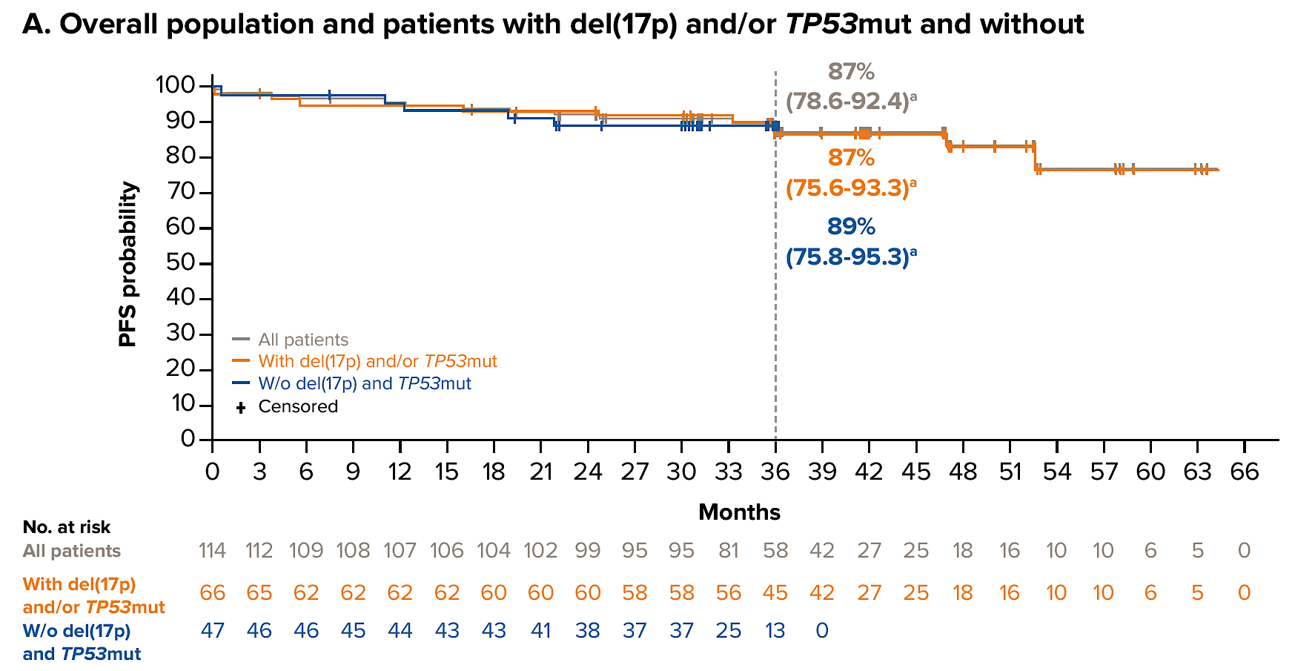
Phase III SEQUOIA Arm D: PFS
Shadman M et al. ASH 2025;Abstract 5669.

Slide 35

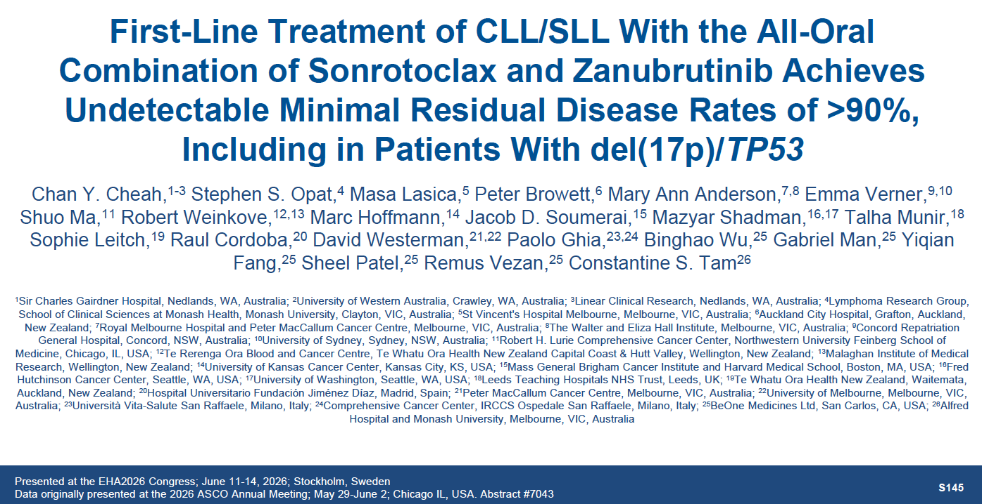
ASCO 2026;Abstract 7043
EHA 2026;Abstract S145

Slide 36
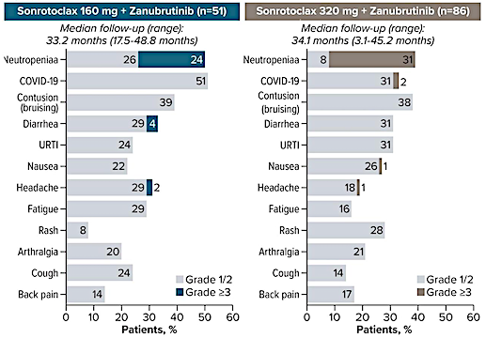
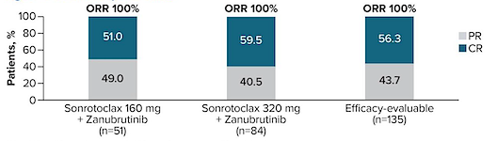
BGB-11417-101 Trial: Overall Response Rates (ORR) and Treatment-Emergent Adverse Events with Sonrotoclax and Zanubrutinib
PR = partial response; CR = complete response; URTI = upper respiratory tract infection
Tam CS et al. ASCO 2026;Abstract 7043; Cheah CY et al. EHA 2026;Abstract S145.

Slide 37
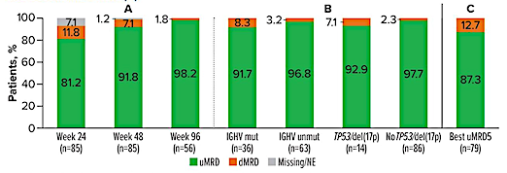
BGB-11417-101: Best uMRD4 Rates over Time with Sonrotoclax 320 mg (A), by Week 96 Subgroup in All Cohorts (B) and Best uMRD5 Rate (C)
uMRD4 = undetectable minimal residual disease at 10⁻⁴ sensitivity; uMRD5 = undetectable minimal residual disease at 10⁻⁵ sensitivity
Tam CS et al. ASCO 2026;Abstract 7043; Cheah CY et al. EHA 2026;Abstract S145.

Slide 38
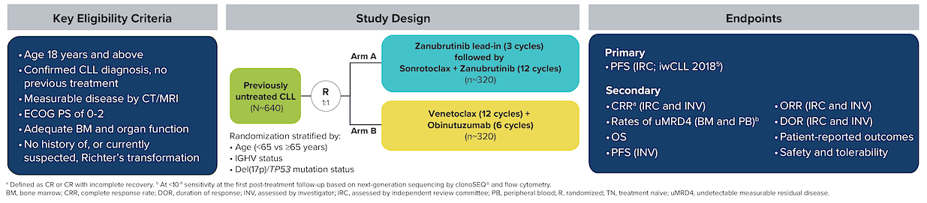
Ongoing CELESTIAL-TNCLL Phase III Trial Schema
ORR = overall response rate
Shadman M et al. ASCO 2024;Abstract TPS7087.

Slide 39
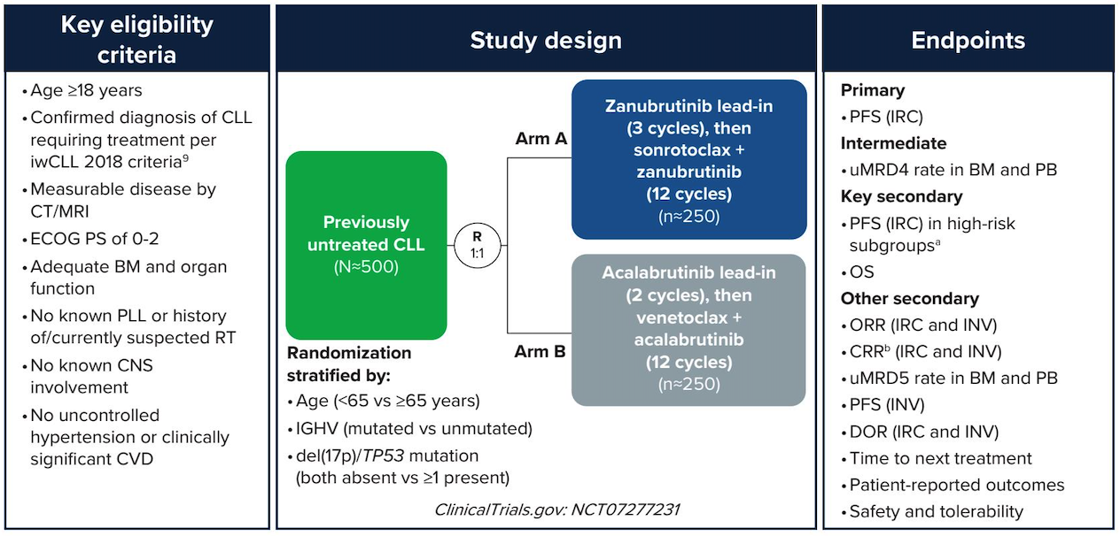
Ongoing CELESTIAL-TNCLL-2 Phase III Trial Schema
PLL = prolymphocytic leukemia; ORR = overall response rate; INV = investigator-assessed; DOR = duration of response
Shadman M et al. ASCO 2026;Abstract TPS7099.

Slide 40
Phase III CELESTIAL-RRCLL Study Design
Randomization will be stratified by
Del(17p)/TP53 mutation status
Prior Bcl2i treatment
Refractoriness to prior BTKi treatment
Sonrotoclax + obinutuzumab
Sonrotoclax + rituximab
R/R CLL or SLL ≥1 prior treatment
R
2:2:1:2
Sonrotoclax + obinutuzumab with MRD-guided therapy
Primary endpoint: PFS (BICR) of SO versus VR
Key secondary endpoint: PFS of SR versus VR
Venetoclax + rituximab
Bcl2i = Bcl-2 inhibitor; BTKi = Bruton tyrosine kinase inhibitor; R/R = relapsed/refractory; BICR = blinded independent central review; SO = sonrotoclax with obinutuzumab; VR = venetoclax with rituximab; SR = sonrotoclax with rituximab
Al-Sawaf O et al. ASH 2025;Abstract 2137.

Slide 41
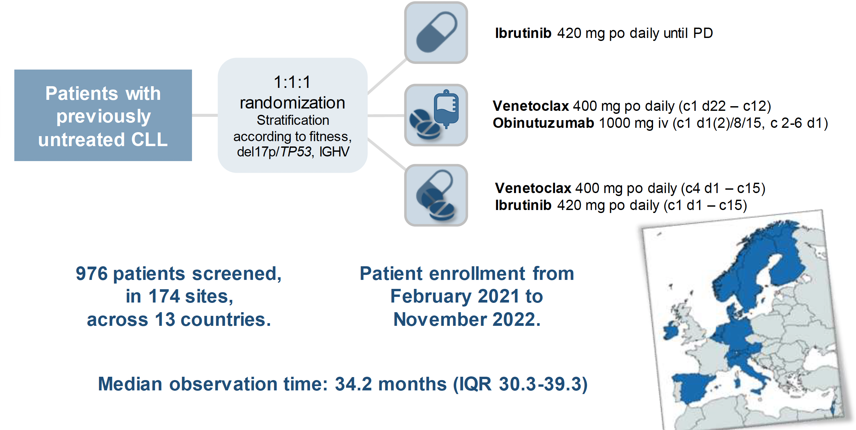
CLL17 Trial Design
Al-Sawaf O et al. ASH 2025;Abstract 1.

Slide 42
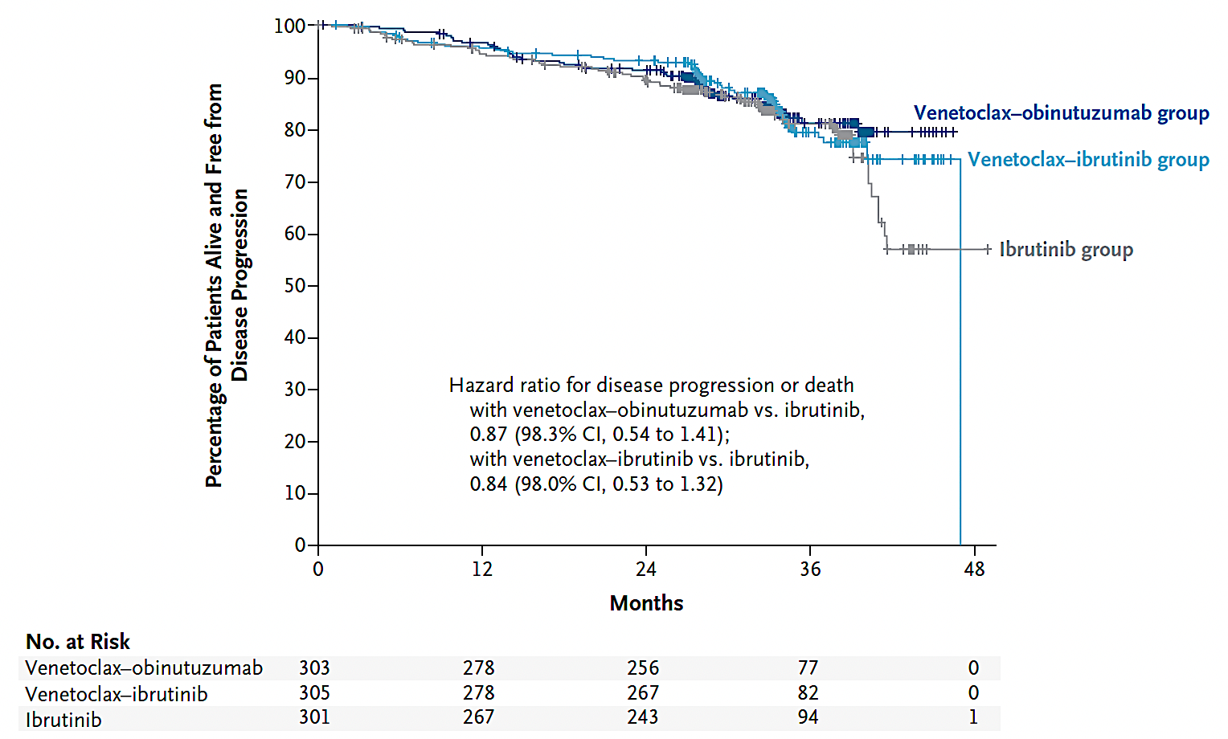
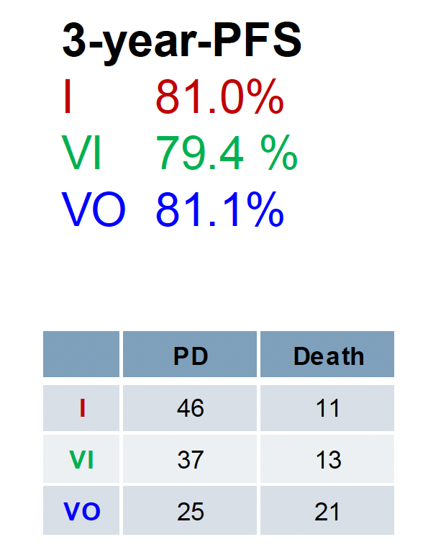
CLL17 Primary Endpoint: Progression-Free Survival at 3 Years
Al-Sawaf O et al. ASH 2025;Abstract 1; Al-Sawaf O et al. N Engl J Med 2026;394(11):1084-96.

Slide 43
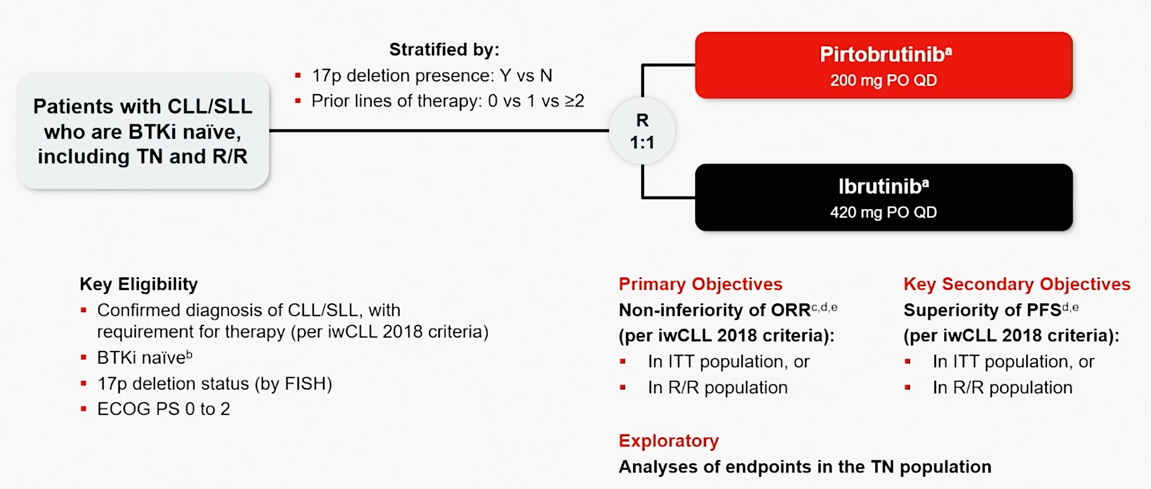
BRUIN CLL-314 Study Design
TN = treatment naïve; R/R = relapsed/refractory; ORR = overall response rate; ITT = intention-to-treat
Woyach J et al. ASH 2025;Abstract 683; Woyach JA et al. J Clin Oncol 2026;44(6):476-85.

Slide 44
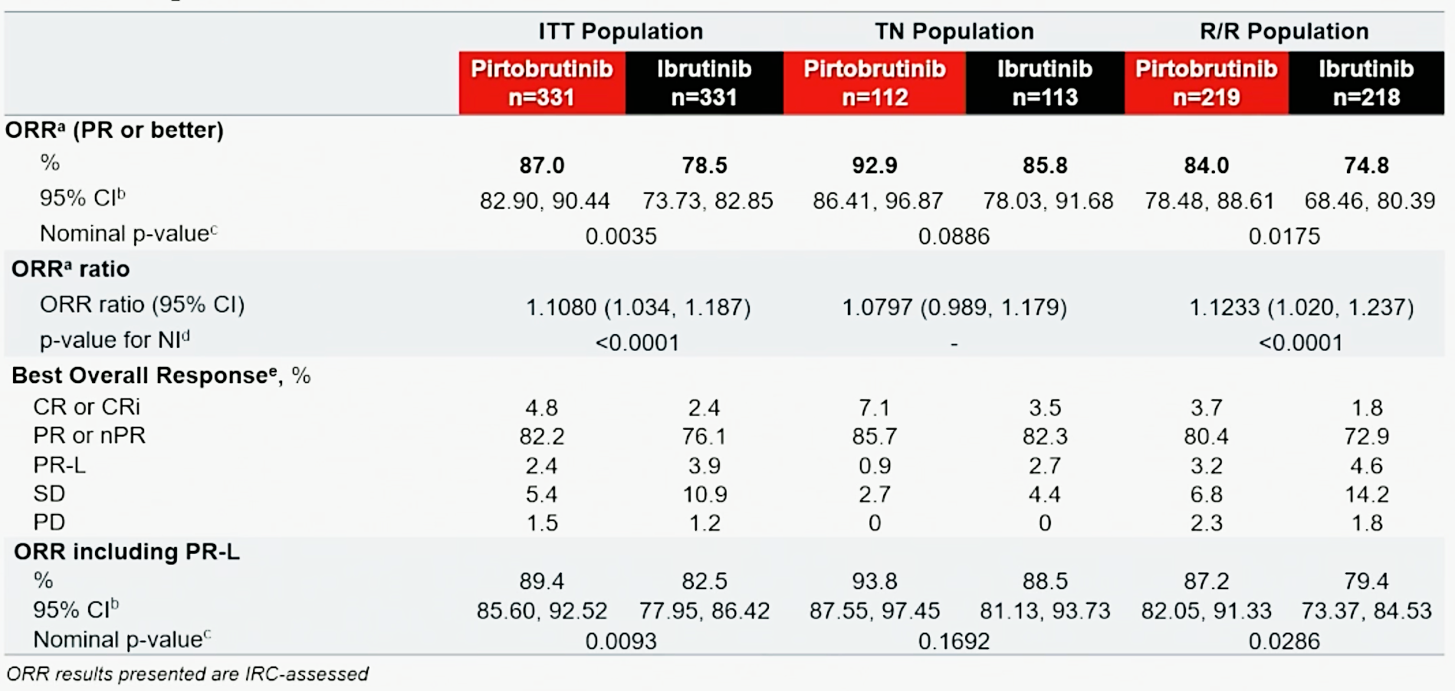
BRUIN CLL-314: Response Data
ORR = overall response rate; NI = noninferiority; PR-L = partial remission with lymphocytosis
Woyach J et al. ASH 2025;Abstract 683; Woyach JA et al. J Clin Oncol 2026;44(6):476-85.

Slide 45
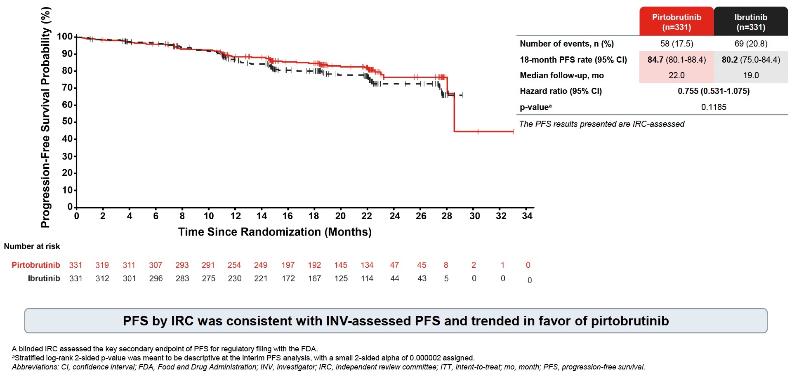
Phase III BRUIN CLL-314: PFS by IRC (ITT Population)
Woyach JA et al. ASH 2025;Abstract 683.
Woyach JA et al. J Clin Oncol 2026;44(6):476-85.

Slide 46
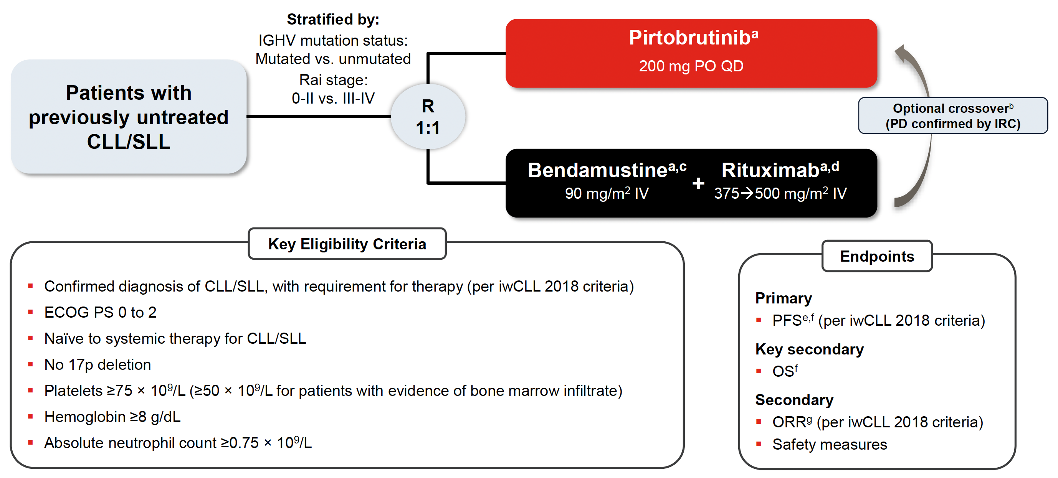
BRUIN CLL-313 Study Design
ORR = overall response rate
Jurczak W et al. ASH 2025;Abstract LBA3; J Clin Oncol 2026;44(6):466-75.

Slide 47
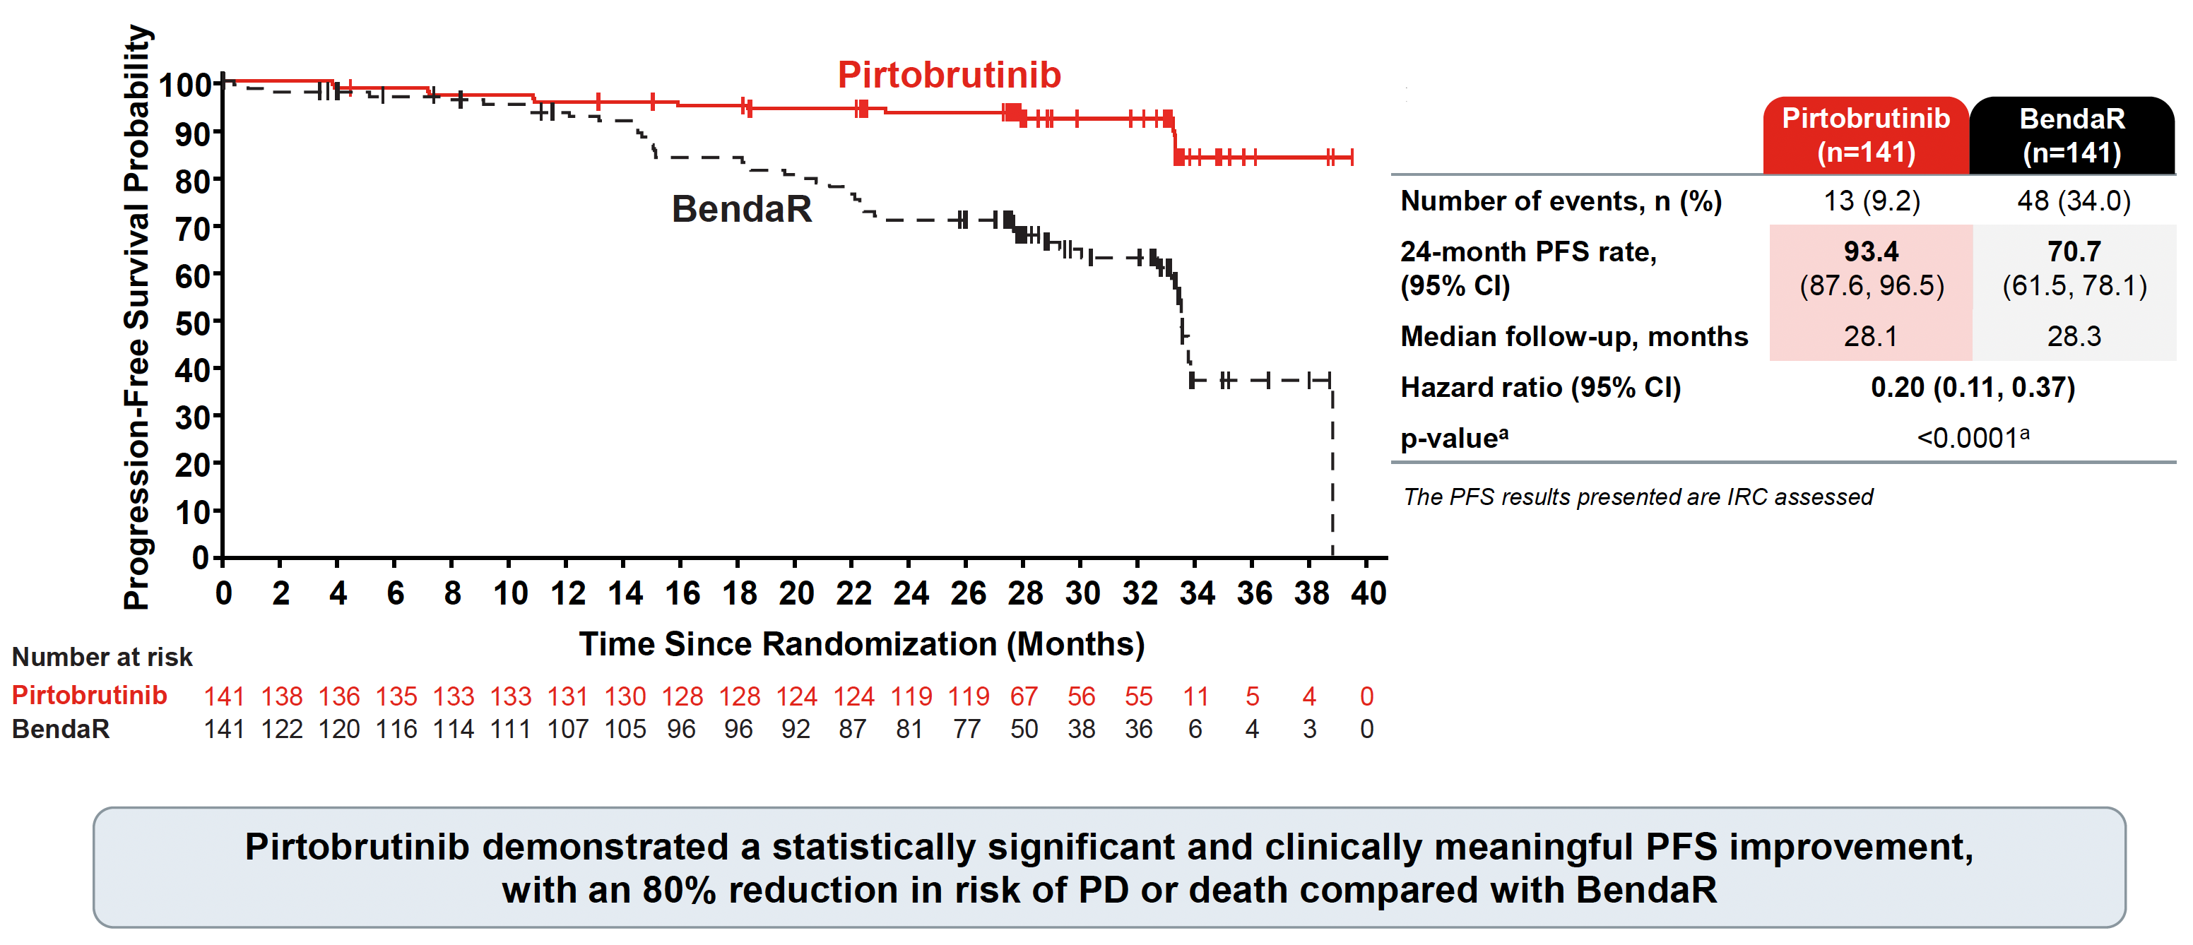
BRUIN CLL-313: PFS Outcomes
Jurczak W et al. ASH 2025;Abstract LBA3; J Clin Oncol 2026;44(6):466-75.

Slide 48
My Algorithm for Front-Line Therapy
No indication
del(17p) and/or TP53 mutation or
IGHV unmutated (any age)
Preferred
Acalabrutinib ± obinutuzumab
Acalabrutinib + venetoclax ± obinutuzumab
Zanubrutinib
Less preferred
  Venetoclax + obinutuzumab
Observe
CLL or SLL Stage II-IV
Treatment?
Indication
present
TP53 wildtype and/or no del(17p) or IGHV mutated (any age)
Acalabrutinib ± obinutuzumab
Acalabrutinib + venetoclax ± obinutuzumab
Venetoclax + obinutuzumab
Zanubrutinib
Content courtesy of Farrukh T Awan, MD

Slide 49
Cases and Discussion Questions
72-year-old gentleman with hemolytic anemia. Bone marrow biopsy: 90% CLL. Prefers not to visit the doctor very often. Treated with zanubrutinib.
Zanetta S Lamar, MD
For a patient with CLL for whom you are going to initiate treatment with a BTK inhibitor, which do you prefer? How do various comorbidities and/or patient preferences influence your selection?

Slide 50
Cases and Discussion Questions
79-year-old gentleman with CLL initially treated with acalabrutinib. Stopped after 2 years in remission due to headaches, hypertension and bruising on his skin. Progressed 2 years later and has responded to pirtobrutinib with no side effects.
Stephen “Fred” Divers, MD
Based on the results from BRUIN CLL-313 and BRUIN CLL-314, are there situations in which you will consider pirtobrutinib as first-line treatment?
Would you consider switching to pirtobrutinib for a patient who is receiving a covalent BTK inhibitor in the first-line setting and is experiencing significant issues with tolerability?

Slide 51
Agenda
Module 1 — Chronic Lymphocytic Leukemia: Dr Awan
First-Line Therapy
Relapsed/Refractory Disease

Slide 52
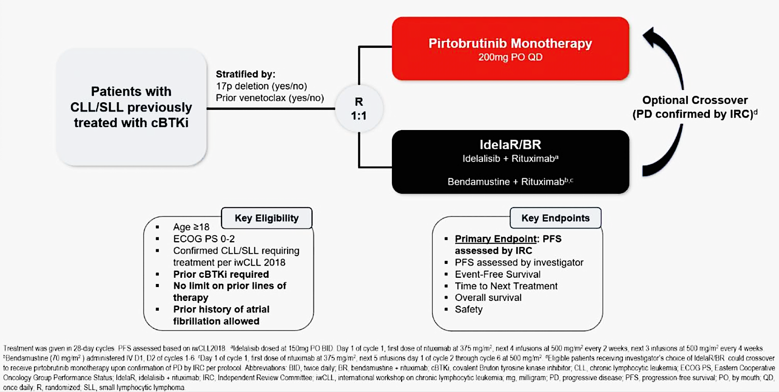
BRUIN CLL-321: A Phase III Trial of Pirtobrutinib Monotherapy for Relapsed/Refractory CLL
Sharman JP et al. ASH 2024;Abstract 886.

Slide 53
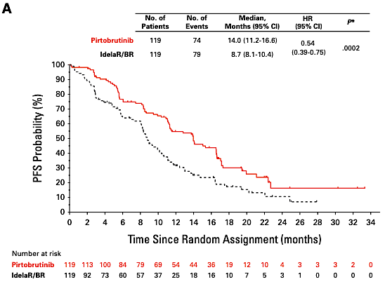
BRUIN CLL-321: IRC-Assessed Progression-Free Survival (PFS)
IRC = independent review committee
Sharman JP et al. J Clin Oncol 2025;43:2538-49.

Slide 54
FDA Grants Traditional Approval to Pirtobrutinib for Chronic Lymphocytic Leukemia and Small Lymphocytic Lymphoma
Press Release: December 3, 2025
“... the Food and Drug Administration granted traditional approval to pirtobrutinib for adults with relapsed or refractory chronic lymphocytic leukemia or small lymphocytic lymphoma (CLL/SLL) who have previously been treated with a covalent BTK inhibitor.
Efficacy was evaluated in BRUIN-CLL-321 (NCT 04666038), a randomized, open-label, active-controlled trial. The trial randomized 238 patients who were previously treated for CLL/SLL, including a covalent BTK inhibitor. Patients previously treated with a non-covalent BTK inhibitor were not permitted. Patients were randomized (1:1) to receive either pirtobrutinib or investigator’s choice of idelalisib plus a rituximab product (IR) or bendamustine plus a rituximab product (BR).
Median PFS was 11.2 months (95% CI: 9.5, 11.4) in the pirtobrutinib arm and 8.7 months (95% CI: 7.2, 10.2) in the investigator’s choice of IR/BR arm (Hazard ratio 0.58 [95% CI: 0.38, 0.89]; p-value 0.0105). Of the 119 patients in the investigator’s choice arm, 50 crossed over to receive pirtobrutinib therapy. At an updated analysis with a median follow-up time of 19.8 months, the HR for overall survival (OS) was 1.09 (95% CI: 0.68, 1.75).”
https://www.fda.gov/drugs/resources-information-approved-drugs/fda-grants-traditional-approval-pirtobrutinib-chronic-lymphocytic-leukemia-and-small-lymphocytic

Slide 55
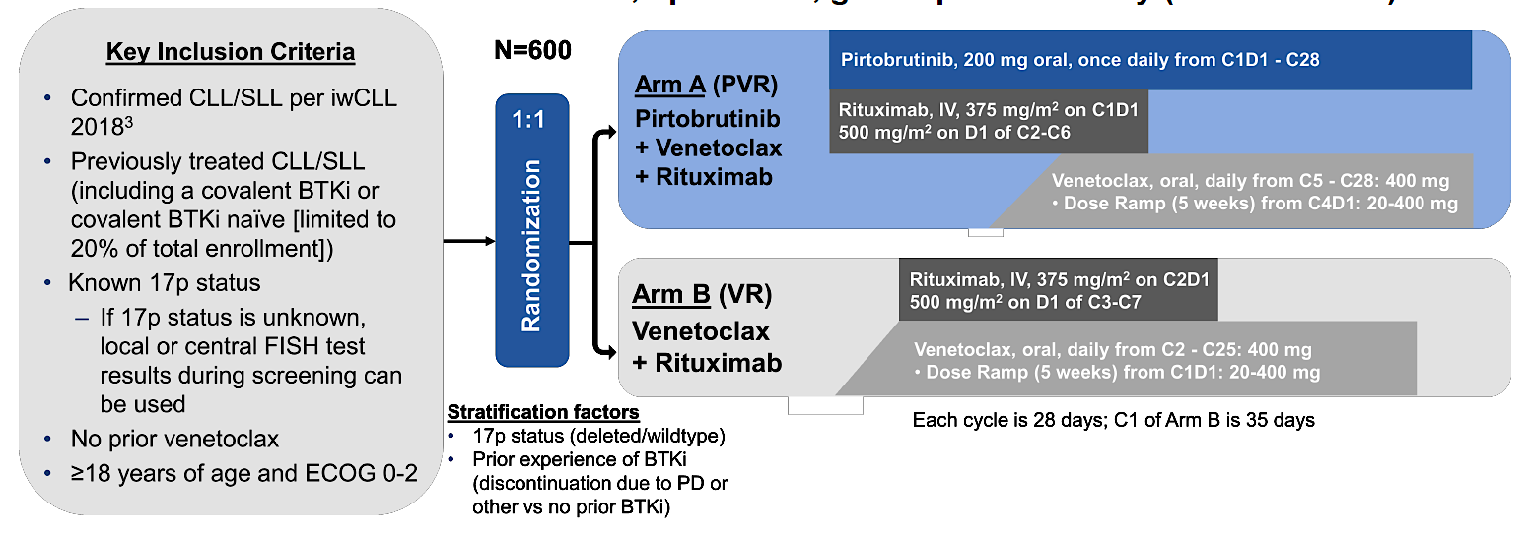
Phase III BRUIN CLL-322 Trial: Pirtobrutinib and Venetoclax/Rituximab in R/R Setting
Primary endpoint: Progression-free survival per iwCLL 2018 by IRC
Eyre TA et al. ASCO 2023;Abstract TPS7583. Wierda WG et al. SOHO 2022;Abstract CLL-322.

Slide 56
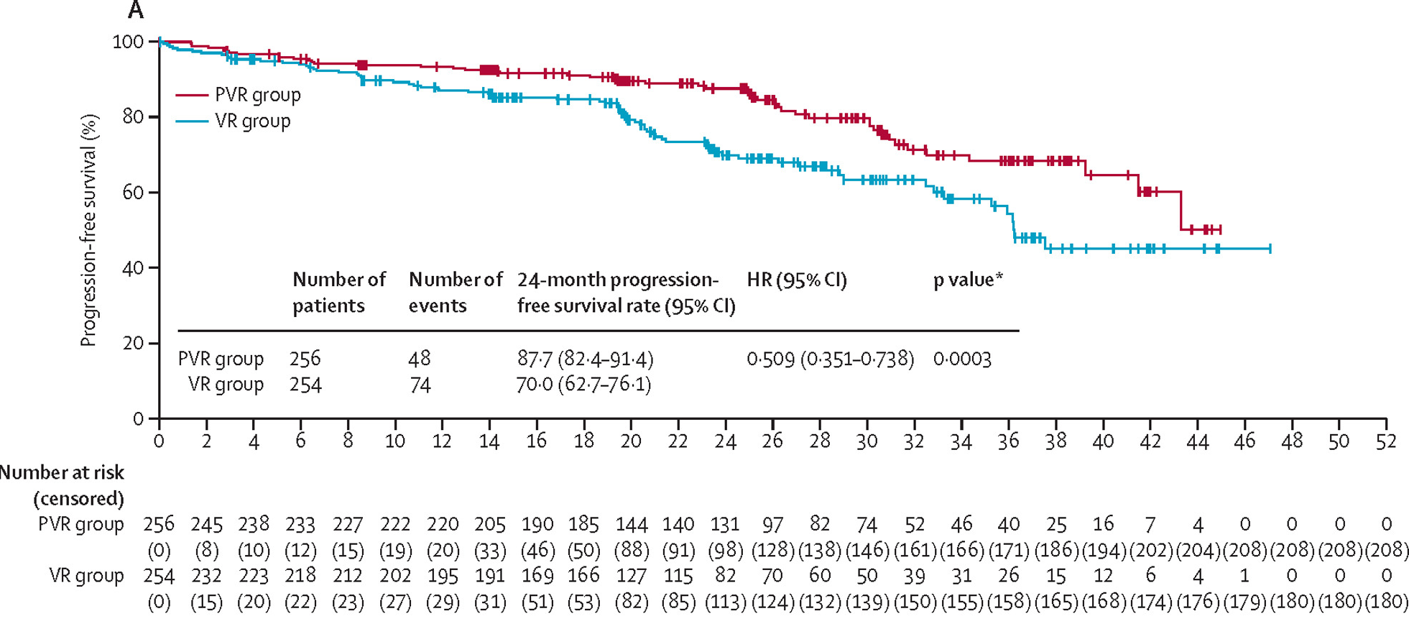
Phase III BRUIN CLL-322 Trial: Pirtobrutinib and Venetoclax/Rituximab in R/R Setting (Continued)
Davids MS et al. Lancet 2026;408(10553):453-70.

Slide 57
Algorithm for Relapsed/Refractory CLL/SLL
Venetoclax + anti-CD20 antibody
Pirtobrutinib/venetoclax + anti-CD20 antibody
Alternate cBTKi if discontinued due to intolerance
No indication
Prior cBTKi
Acalabrutinib ± anti-CD20 antibody
Pirtobrutinib/venetoclax + anti-CD20 antibody
Zanubrutinib
Repeat Bcl-2i +anti-CD20 antibody (if time-limited Bcl-2i received with duration of remission ≥2 yr)
Observe
Prior Bcl-2i
Relapsed/
refractory CLL/SLL
Treatment indicated?
Acalabrutinib ± obinutuzumab
Pirtobrutinib/venetoclax + anti-CD20 antibody
Zanubrutinib
Venetoclax + rituximab/obinutuzumab
Prior CIT
Prior cBTKi and Bcl-2i (double refractory)
Pirtobrutinib/venetoclax + anti-CD20 antibody
Consider retreatment with prior cBTKi or Bcl-2i (if pt received time-limited tx and achieved remission ≥2 yr)
Indication
present
CAR T-cell therapy
Lisocabtagene maraleucel
cBTKi = covalent BTKi; pt = patient; tx = treatment
Content courtesy of Farrukh T Awan, MD

Slide 58
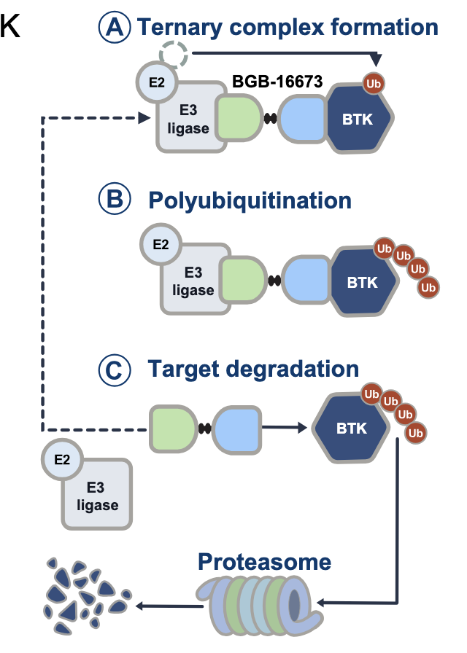
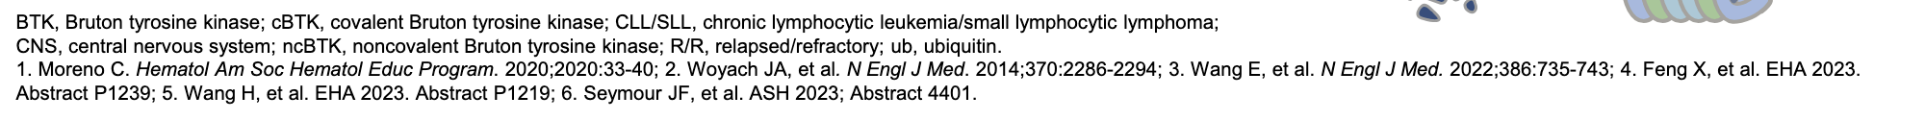
BGB-16673: A Chimeric Degradation Activating Compound
BGB-16673 is an orally available protein degrader that blocks BTK signaling by tagging BTK for degradation through the cell’s proteasome pathway, leading to tumor regression
Scarfò L et al. EHA 2025;Abstract S158.

Slide 59
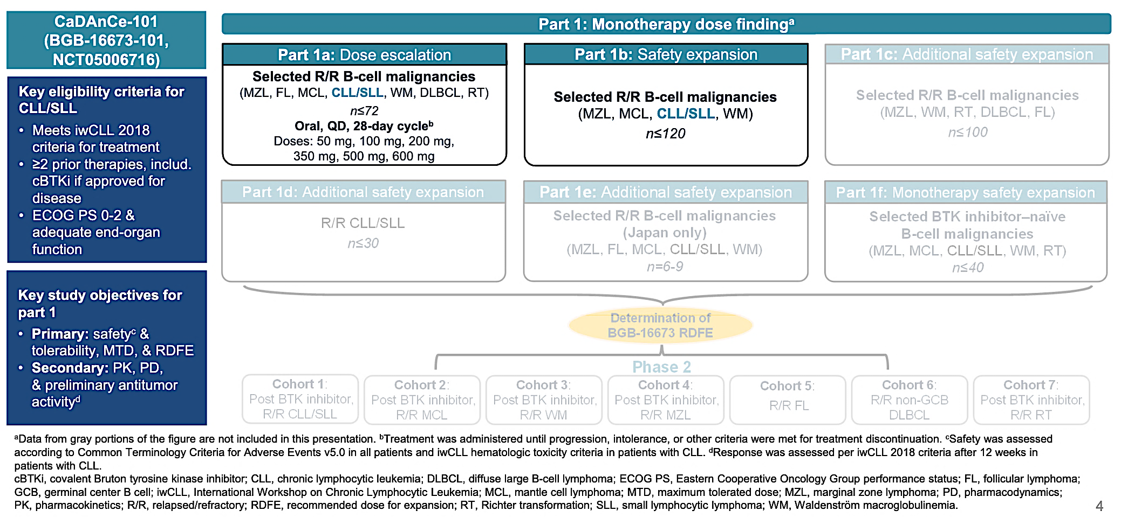
CaDAnCe-101: A Phase I/II Dose-Escalation/Expansion Study of BGB-16673 for R/R B-Cell Cancers
Scarfò L et al. EHA 2025;Abstract S158.

Slide 60
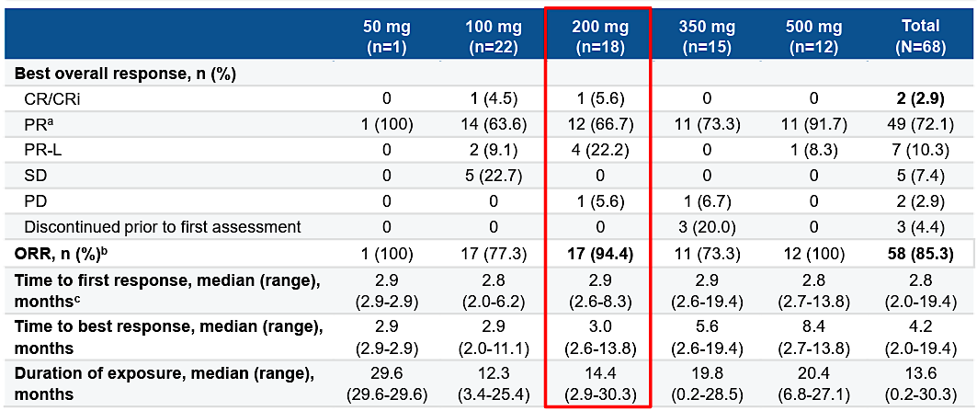
CaDAnCe-101: Response Data
ORR = overall response rate
Ahn I et al. ASH 2025;Abstract 85.

Slide 61
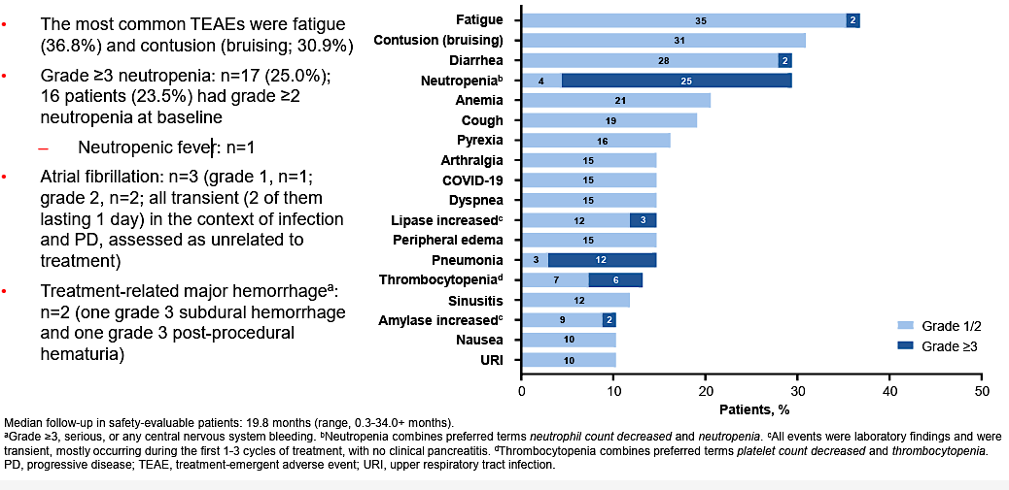
CaDAnCe-101: Safety Profile
Neutropenic fever: n=1
Ahn I et al. ASH 2025;Abstract 85.

Slide 62
Phase III CaDAnCE-302 Study Design
BGB-16673
N ~ 250
R/R CLL or SLL Previously exposed to both BTKi and Bcl-2i
R
3:2
Investigator’s choice
Idelalisib + R
Bendamustine + R
Venetoclax + R
Primary endpoint: PFS
R = rituximab
www.clinicaltrials.gov. NCT06846671. Accessed August 2026.

Slide 63
Phase III SOUNDTRACK-C1 Study Design
Surovatamig
N ~ 420
CLL or SLL Unmutated IGHV Treatment received and response at end of first-line finite therapy
R
Observation
Primary endpoint: PFS
www.clinicaltrials.gov. NCT07509151. Accessed August 2026.

Slide 64
Cases and Discussion Questions
59-year-old man with CLL and a TP53 mutation diagnosed 8 years ago.
S/p acalabrutinib, venetoclax + obinutuzumab, pirtobrutinib.
Sunil Babu, MD
In which line of therapy are you generally employing pirtobrutinib for your patients with R/R CLL? Are there any situations in which you currently employ pirtobrutinib for patients who have experienced disease progression on either a covalent BTK inhibitor or venetoclax but not both?
For which patients would you favor pirtobrutinib/venetoclax/rituximab over pirtobrutinib monotherapy in the R/R setting?

Slide 65
Cases and Discussion Questions (Continued)
At what point in the treatment course are you referring your patients with CLL for consultation regarding CAR T-cell therapy?
Based on available data and your personal clinical experience, how would you compare the novel Bcl-2 inhibitor sonrotoclax to venetoclax in terms of efficacy and tolerability? If sonrotoclax were available, in which situations would you prioritize it over venetoclax?
What other novel agents and strategies currently being explored in CLL are you most excited about? Bispecific antibodies (eg, epcoritamab, surovatamig)? BTK degraders (eg, tacabrutideg, bexobrutideg)?

Slide 66
Cases and Discussion Questions
88-year-old (not retired) professor with CLL and excellent performance status. Previously treated with a BTK inhibitor but now developing worsening abdominal pain. Increased LDH. PET scan shows high SUV. Biopsy: Richter’s transformation.
Patient received R-mini-CHOP with improvement in abdominal pain.
Zanetta S Lamar, MD
What would you most likely recommend as the next line of therapy for this patient? How do you think through the care of patients with CLL and Richter’s transformation?

Slide 67
Up Next …
Dr Samuel Klempner discusses the management of gastroesophageal cancers

Slide 68
Integrating New Advances into
Community Oncology Practice
A Multitumor Symposium Hosted in Conjunction with the American Oncology Network
CME/MOC, NCPD and ACPE Accredited
Saturday, August 22, 2026
9:00 AM – 2:20 PM CT

Slide 69
Agenda
Module 1 — Chronic Lymphocytic Leukemia
Farrukh T Awan, MD, MS, MBA
Module 2 — Gastroesophageal Cancers
Samuel J Klempner, MD
Module 3 — Ovarian and Endometrial Cancer
Shannon N Westin, MD, MPH, FASCO, FACOG
Module 4 — Diffuse Large B-Cell Lymphoma
Ann LaCasce, MD, MMSc
Module 5 — Lung Cancer
Stephen V Liu, MD

Slide 70

Gastroesophageal Cancers Faculty
Samuel J Klempner, MD
Program Director, Gastroesophageal Cancers
Tobins Family Endowed Chair in Esophagogastric Cancer
Massachusetts General Hospital
Associate Professor, Harvard Medical School
Boston, Massachusetts
MODERATOR
Stephen “Fred” Divers, MD
Chief Medical Officer
American Oncology Network
Board Executive
Community Oncology Alliance
Hot Springs, Arkansas

Slide 71
Dr Klempner — Disclosures
Advisory Committees | Astellas, AstraZeneca Pharmaceuticals LP, BeOne, Boehringer Ingelheim Pharmaceuticals Inc, Bristol Myers Squibb, Daiichi Sankyo Inc, Eisai Inc, Elevation Oncology, EsoBiotec, Gilead Sciences Inc, I-Mab Biopharma, Jazz Pharmaceuticals Inc, Merck, Mersana Therapeutics Inc, Natera Inc, Novartis, Signet Therapeutics, Taiho Oncology Inc
Consulting Agreements | Astellas
Contracted Research | Arcus Biosciences, AstraZeneca Pharmaceuticals LP, I-Mab Biopharma, Mersana Therapeutics Inc, Parabilis Medicines
Data and Safety Monitoring Boards/Committees | Sanofi
Stock OPTIONS — Private Companies | MBrace Therapeutics
Nonrelevant Financial Relationships | Debbie’s Dream Foundation, Degregorio Family Foundation, Gastric Cancer Foundation, National Cancer Institute/National Institutes of Health, NCCN (member of Gastric and Esophageal Guidelines Committees), Stand Up 2 Cancer/AACR, Torrey Coast Foundation

Slide 72
Dr Divers — Disclosures
Advisory Committees | Daiichi Sankyo Inc

Slide 73
Snapshot of AON Practice
Gastroesophageal Cancers

Slide 74
Snapshot of AON Practice
Gastroesophageal Cancers — Immunotherapy

Slide 75
Snapshot of AON Practice
Gastroesophageal Cancers — CLDN18.2-Positive

Slide 76
Snapshot of AON Practice
Gastroesophageal Cancer — HER2-Positive

Slide 77
Agenda
Module 2 — Gastroesophageal Cancers: Dr Klempner
First-Line Treatment of Metastatic Gastroesophageal Cancer
Management of HER2-Positive Gastroesophageal Cancer
Neoadjuvant Therapy for Gastroesophageal Cancer

Slide 78
Cases and Discussion Questions
A 58-year-old woman has metastatic GE junction adenocarcinoma with liver and nodal metastases. HER2 is negative, PD-L1 CPS is 3, MMR is proficient and CLDN18.2 is negative. ECOG is 1.
Sunil Babu, MD
In a patient with low or intermediate PD-L1 expression and no other actionable biomarkers, how do you decide whether to add a checkpoint inhibitor to first-line chemotherapy? Is your thinking different for gastric versus esophageal cancer? What about adenocarcinoma versus squamous cell carcinoma?

Slide 79
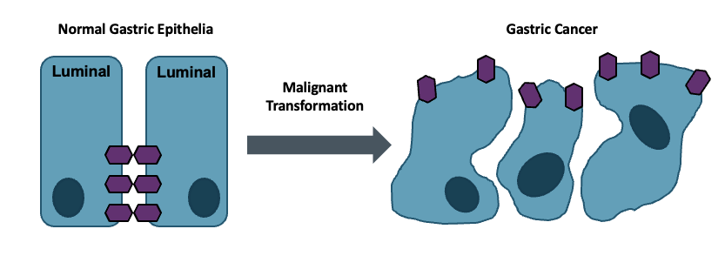
Claudin 18.2: Leveraging Biology
Claudin 18.2 is a major structural component of intercellular tight junctions
Not routinely expressed in any normal tissue outside gastric mucosa (cancer-restricted antigen)
Broadly expressed in several tumor types, including gastric, GEJ, biliary and pancreatic
Baek JH et al. Anticancer Res 2019;39(12):6973-9.
.

Slide 80
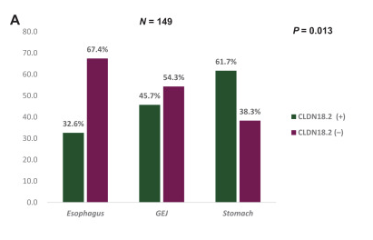
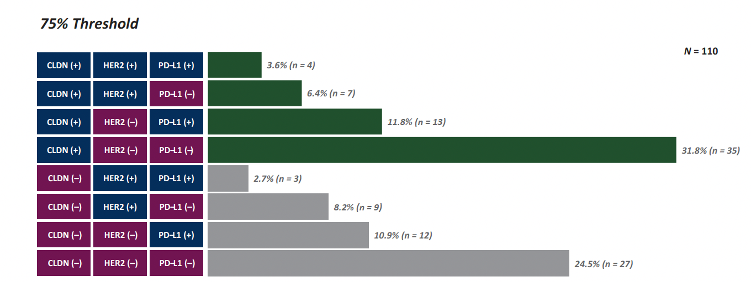
Claudin 18.2: Characteristics and Overlap
CLDN 18.2 positivity rates:
  Highest in gastric followed by GEJ and esophagus
  48.3% (75% threshold: ≥75% of tumor cells with 2-3+ staining)
  71.1% (H-score 25; ≥1+ intensity in ≥25% of cells)
  73.8% (H-score 10; ≥1+ intensity in ≥10% of cells)
•
No significant association with HER2, PD-L1 CPS or mismatch repair
~30% sole biomarker
•
Maeng CH et al. ESMO Gastrointest Oncol 2026;11:100278.

Slide 81
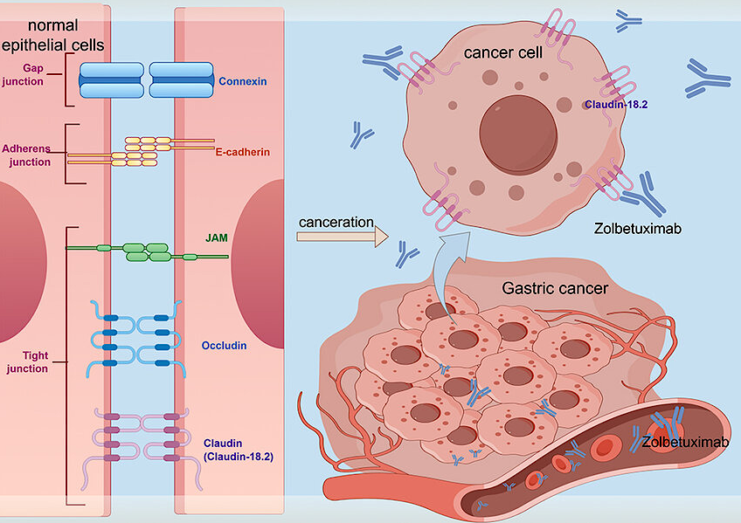
Zolbetuximab Mechanism of Action
Du F et al. J Hepatocell Carcinoma 2024;11:1801-21 .

Slide 82
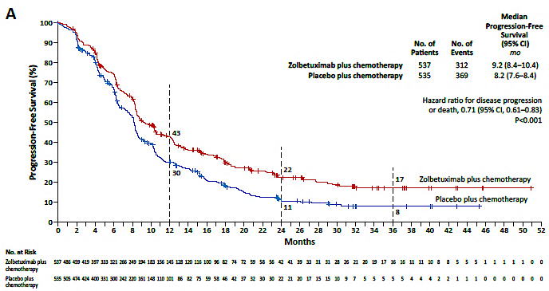
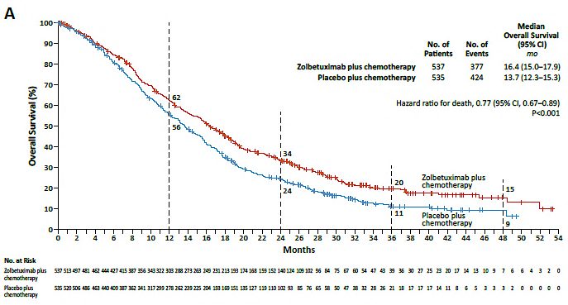
SPOTLIGHT and GLOW Trials Combined Analysis: Survival with First-Line Zolbetuximab and Chemotherapy for Gastric or GEJ Adenocarcinoma
Updated PFS
Final OS Analysis
Shitara K et al. N Engl J Med 2024;391(12):1159-62.

Slide 83
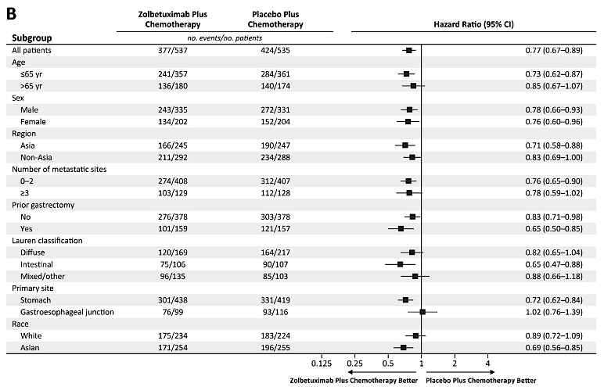
SPOTLIGHT and GLOW Combined Analysis: Overall Survival with First-Line Zolbetuximab and Chemotherapy for Gastric or GEJ Adenocarcinoma
Shitara K et al. N Engl J Med 2024;391(12):1159-62.

Slide 84
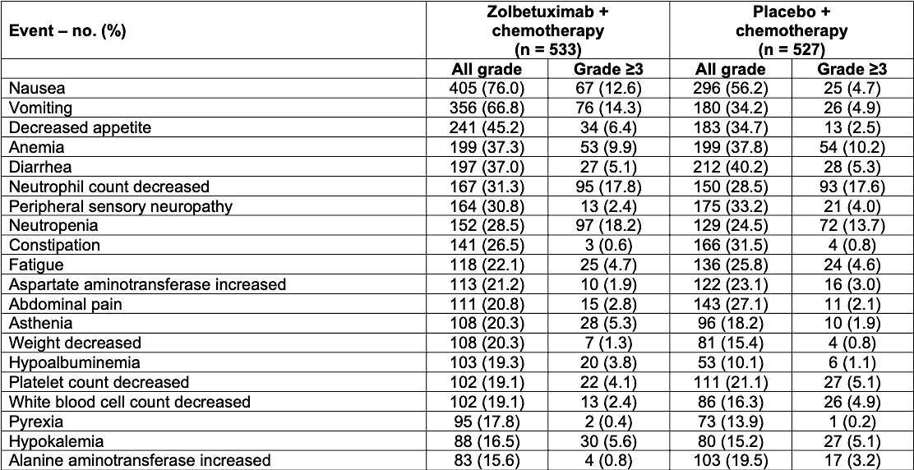
SPOTLIGHT and GLOW Combined Analysis: Treatment-Emergent
Adverse Events
Shitara K et al. N Engl J Med 2024;391(12):1159-62.

Slide 85
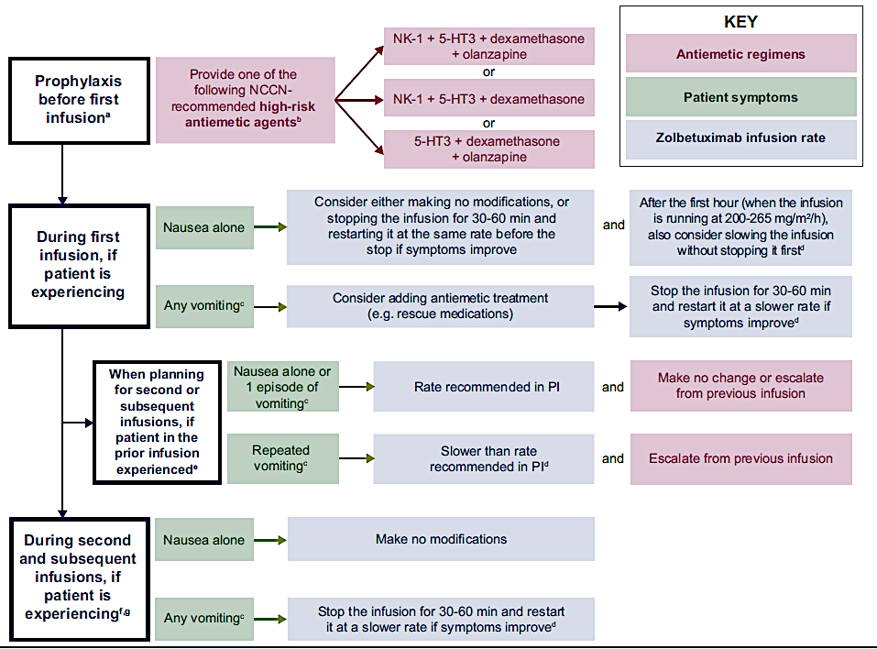
Zolbetuximab: Management of Nausea and Vomiting
Klempner SJ et al. ESMO Gastrointest Oncol 2025;7:100131.

Slide 86
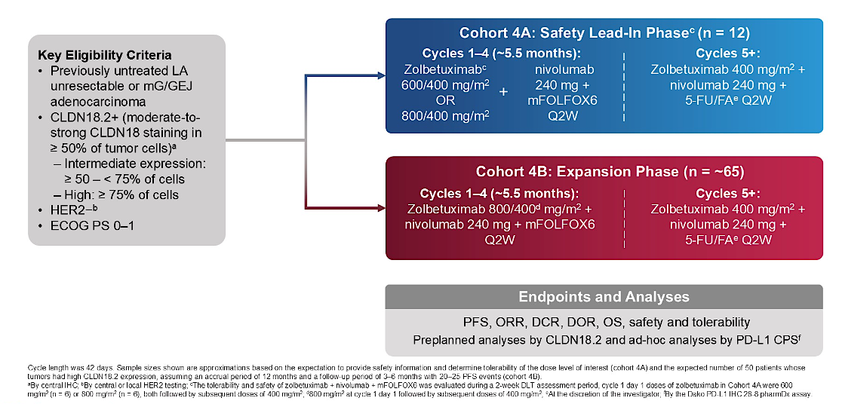
Phase II ILUSTRO Study of First-Line Zolbetuximab with mFOLFOX6 and Nivolumab for CLDN18.2-Positive Locally Advanced Unresectable or Metastatic Gastric or GEJ Adenocarcinoma: Cohort 4
mFOLFOX6 = modified FOLFOX-6; LA = locally advanced
Shitara K et al. Gastrointestinal Cancers Symposium 2026;Abstract LBA284.

Slide 87
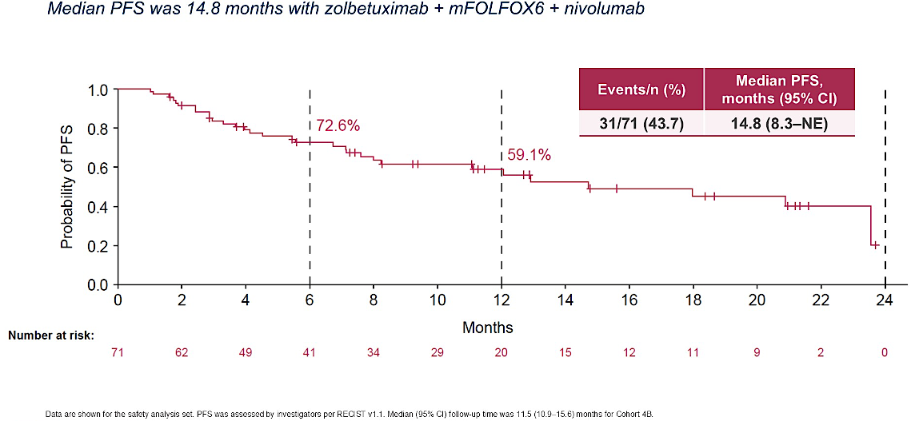
ILUSTRO Cohort 4B: PFS with First-Line Zolbetuximab, Nivolumab and mFOLFOX6
Shitara K et al. Gastrointestinal Cancers Symposium 2026;Abstract LBA284; Shitara K et al. Nat Med 2026;32(6):2182-90.

Slide 88
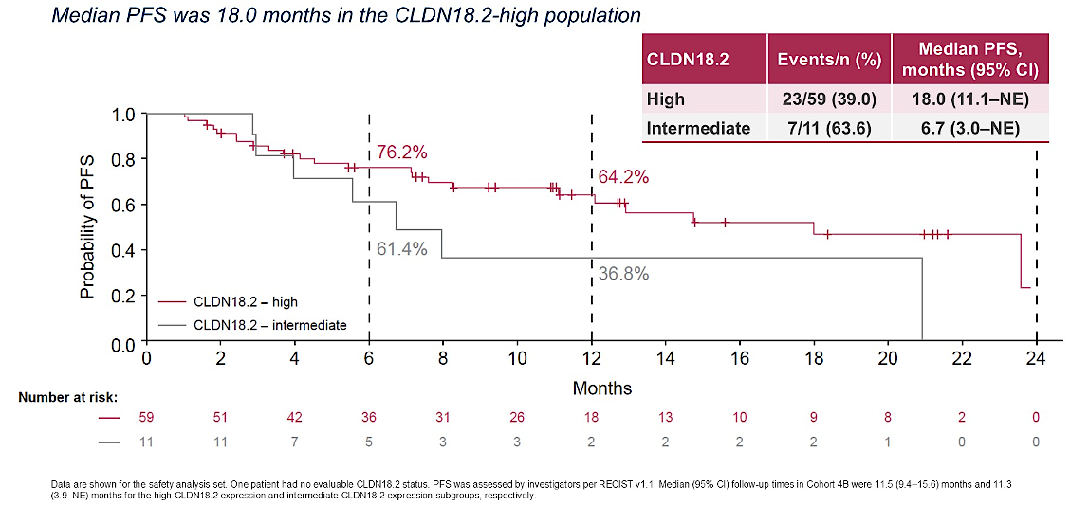
ILUSTRO Cohort 4B: PFS with First-Line Zolbetuximab, Nivolumab and mFOLFOX6, Stratified by CLDN18.2 Expression
Shitara K et al. Gastrointestinal Cancers Symposium 2026;Abstract LBA284; Shitara K et al. Nat Med 2026;32(6):2182-90.

Slide 89
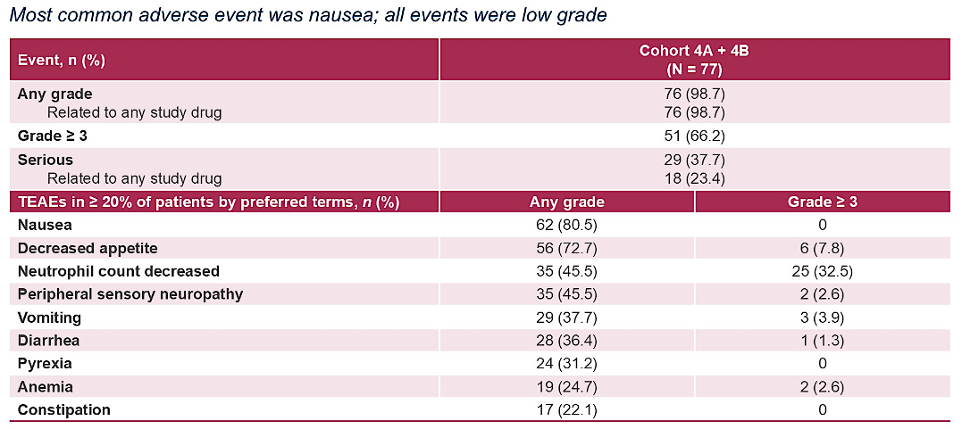
ILUSTRO: Treatment-Emergent Adverse Events with First-Line Zolbetuximab and Nivolumab — Cohorts 4A and 4B
Shitara K et al. Gastrointestinal Cancers Symposium 2026;Abstract LBA284; Shitara K et al. Nat Med 2026;32(6):2182-90.

Slide 90

Ongoing Phase III LUCERNA Trial of First-Line Zolbetuximab with Pembrolizumab and Chemotherapy for CLDN18.2-Positive, HER2-Negative, PD-L1-Positive Locally Advanced Unresectable or Metastatic Gastric or GEJ Adenocarcinoma
Shitara K et al. Gastrointestinal Cancers Symposium 2026;Abstract TPS473.

Slide 91


Expanding Therapy Beyond Zolbetuximab
Antibody-drug conjugates (ADCs)
Bispecific antibodies and BiTEs
Made on Biorender.com
Made on Biorender.com
Sonesitatug vedotin (AZD0901) – CLDN18.2 ADC with MMAE payload
EO-3021 – CLDN18.2 ADC with MMAE payload
IBI343 -- CLDN18.2 ADC with TOPO I payload
SHR-A1904 -- CLDN18.2 ADC with TOPO I payload
Givastomig – CLDN18.2 x 4-1BB bispecific
PT886 – CLDN18.2 x CD47 bispecific
ASP2138 – CLDN18.2 x CD3 BiTE
AZD5863 -- CLDN18.2 x CD3 BiTE
BiTE = bispecific T-cell engager

Slide 92


CLARITY-PanTumor01 Substudy 1: Sonesitatug Vedotin Activity in Gastric and GEJ Cancer
ORR 28.4%
TEAs occurring in ≥10% of patients overall
CR = complete response; PR = partial response; SD = stable disease; PD = progressive disease; NE = not evaluable; ORR = objective response rate
Shitara K et al. ASCO 2026;Abstract 4023.

Slide 93

Phase III CLARITY-Gastric 01 Study: Second-or Later-Line Sonesitatug Vedotin for Advanced Gastric/GEJ Cancer
Primary endpoints: PFS for all patients, OS for patients receiving third-line or later treatment
Estimated completion: October 2026
Shitara K et al. Gastrointestinal Cancers Symposium 2026;Abstract TPS462.

Slide 94
Sonesitatug Vedotin Demonstrated a Statistically Significant Improvement in Overall Survival in Second- and Later-Line Therapy for CLDN18.2-Positive Advanced Gastric/GEJ Cancers
Press Release: July 27, 2026
“Positive high-level results from the CLARITY-Gastric01 global Phase III trial showed that sonesitatug vedotin (Sone-Ve) demonstrated a statistically significant and highly clinically meaningful improvement in overall survival (OS) in 2nd and later-line Claudin 18.2-positive advanced gastric cancers versus investigator’s choice of therapy. The trial included patients with locally advanced or metastatic gastric cancer, gastroesophageal junction (GEJ) cancer, or esophageal adenocarcinoma (EAC) with Claudin 18.2 (CLDN18.2) expression on at least 25% of tumor cells at any staining intensity.
The trial had dual primary endpoints of OS in 3rd and later-line treatment and progression-free survival (PFS) in the overall trial population. The trial met the dual primary endpoint of OS in 3rd and later-line treatment, and a key secondary endpoint of OS in the overall trial population of patients treated in the 2nd and later-line setting, demonstrating a statistically significant and highly clinically meaningful improvement.
For the other dual primary endpoint of PFS as assessed by blinded independent central review (BICR), results showed a trend toward improved PFS in patients treated in the 2nd and later-line setting but did not reach statistical significance.”
https://www.astrazeneca.com/media-centre/press-releases/2026/sone-ve-improved-survival-in-gastric-cancers.html

Slide 95
Ongoing Phase III CLARITY-Gastric 02 Study: First-Line Sonesitatug Vedotin in Combination with Capecitabine with or without Rilvegostomig
Cohort 1: CLDN18.2-positive, PD-L1-positive
Sone-Ve + rilvegostomig + capecitabine
Sone-Ve + nivolumab + capecitabine
Standard nivolumab + CAPOX or FOLFOX
1L GC/GEJC expressing CLDN18.2 (≥25% tumor cells with membranous staining at any intensity for CLDN18.2)
N ≈ 2,130
Cohort 2: CLDN18.2-positive, PD-L1-negative
Sone-Ve + capecitabine
CAPOX or FOLFOX with or without zolbetuximab
Primary endpoints: PFS for cohorts 1 and 2, OS for cohort 1
Secondary endpoints: OS (cohort 2), objective response rate, duration of response, safety
Data anticipated: After 2027
Estimated completion: October 2031
www.clinicaltrials.gov. NCT07431281. Accessed August 2026.

Slide 96
Cases and Discussion Questions
68-year-old male who presented with fatigue, anorexia, 20-lb weight loss, dyspepsia and LUQ pain. EGD showed a 6-cm gastric mass, poorly differentiated adenocarcinoma, HER2 IHC 1+, PD-L1 15%, claudin 18.2-positive. PET/CT showed multiple liver metastases and several peritoneal implants.
Brian P Mulherin, MD
When do you typically conduct CLDN18.2 testing for your patients with advanced gastroesophageal cancers, and what assay do you use?
Assuming no contraindications, how do you choose between zolbetuximab/chemotherapy and IO/chemotherapy for patients who are eligible for both? Does the magnitude of PD-L1 positivity impact your decision?

Slide 97
Cases and Discussion Questions (Continued)
Would you administer both zolbetuximab and an anti-PD-1/PD-L1 antibody in combination with first-line chemotherapy to a patient with newly diagnosed gastric/GEJ adenocarcinoma that expresses both CLDN18.2 and PD-L1?
For a patient with CLDN18.2-positive disease who had already received first-line therapy, would you attempt to employ zolbetuximab in a later line?

Slide 98
Cases and Discussion Questions
45-year-old male with newly diagnosed Stage IV distal esophageal adenocarcinoma, CLDN18.2-positive, PD-L1 10%, HER2-negative and receiving first-line systemic therapy with FOLFOX plus zolbetuximab. He experienced significant nausea/vomiting despite antiemetics, hydration and preemptive therapy.
Jennifer Yannucci, MD
Have you found any helpful strategies for mitigating and managing zolbetuximab-associated nausea and vomiting? Do you find that these side effects generally improve over time?
Is the initial loading dose of zolbetuximab necessary to maintain efficacy? Would omitting the loading dose potentially reduce the incidence of related GI toxicities?

Slide 99
Cases and Discussion Questions (Continued)
What role do you see for CLDN18.2-targeted antibody-drug conjugates in advanced gastroesophageal cancers? Does sonesitatug vedotin have a similar tolerability profile to zolbetuximab?

Slide 100
Agenda
Module 2 — Gastroesophageal Cancers: Dr Klempner
First-Line Treatment of Metastatic Gastroesophageal Cancer
Management of HER2-Positive Gastroesophageal Cancer
Neoadjuvant Therapy for Gastroesophageal Cancer

Slide 101
Cases and Discussion Questions
93-year-old very healthy man with HER2-positive (IHC 3+) metastatic gastric adenocarcinoma, PD-L1 CPS 5. Wanted to pursue treatment and we offered dose-adjusted oxaliplatin/5-FU in combination with pembrolizumab and trastuzumab. He’s done well on his first cycle of treatment.
Stephen “Fred” Divers, MD
If it were available, would you have considered zanidatamab with chemotherapy for this patient? How do you envision zanidatamab being employed in HER2-positive gastroesophageal cancers?
How would you characterize the tolerability profile of zanidatamab? Would you have any qualms about using it for a 93-year-old patient?

Slide 102
Cases and Discussion Questions (Continued)
How would you decide whether or not to include tislelizumab along with zanidatamab and chemotherapy?
Would you be comfortable substituting another anti-PD-1/PD-L1 antibody for tislelizumab when administering zanidatamab and chemotherapy?

Slide 103

KEYNOTE-811 Phase III Trial of Pembrolizumab with Trastuzumab and Chemotherapy for Previously Untreated Advanced HER2-Positive Gastric or Gastroesophageal Junction (GEJ) Adenocarcinoma
Kawazoe A et al. ASCO 2026;Abstract 4040.

Slide 104

KEYNOTE-811: Progression-Free Survival (PFS) with 6-Year Median Follow-Up
ITT
PD-L1 CPS ≥1
ITT = intention to treat; CPS = combined positive score; HR = hazard ratio; CI = confidence interval
Kawazoe A et al. ASCO 2026;Abstract 4040.

Slide 105

KEYNOTE-811: Overall Survival (OS) with 6-Year Median Follow-Up
ITT
PD-L1 CPS ≥1
Kawazoe A et al. ASCO 2026;Abstract 4040.

Slide 106

Zanidatamab Mechanism of Action
Weisser N et al. Nat Commun 2023.
Content courtesy of Eric Van Cutsem, MD, PhD

Slide 107

Phase III HERIZON-GEA-01 Trial of Zanidatamab with or without Tislelizumab for HER2-Positive Gastroesophageal Cancer
Elimova E et al. Gastrointestinal Cancers Symposium 2026;Abstract LBA285.

Slide 108

HERIZON-GEA-01 Primary Endpoint: PFS per BICR with Zanidatamab, Tislelizumab and Chemotherapy (CT)
Elimova E et al. Gastrointestinal Cancers Symposium 2026;Abstract LBA285; Shitara K et al. N Engl J Med 2026;394:2002-14.

Slide 109

HERIZON-GEA-01 Primary Endpoint: Interim Analysis of OS with Zanidatamab, Tislelizumab and Chemotherapy
Elimova E et al. Gastrointestinal Cancers Symposium 2026;Abstract LBA285; Shitara K et al. N Engl J Med 2026;394:2002-14.

Slide 110

HERIZON-GEA-01: Interim OS Analysis with Zanidatamab and Chemotherapy
Elimova E et al. Gastrointestinal Cancers Symposium 2026;Abstract LBA285; Shitara K et al. N Engl J Med 2026;394:2002-14.

Slide 111

HERIZON-GEA-01 Subgroup Analysis: PFS per BICR by PD-L1 Subgroups
Rha SY et al. ASCO 2026;Abstract 4010.

Slide 112

HERIZON-GEA-01 Subgroup Analysis: OS by PD-L1 Subgroups
Rha SY et al. ASCO 2026;Abstract 4010.

Slide 113


HERIZON-GEA-01: Common Treatment-Related Adverse Events
Shitara K et al. N Engl J Med 2026;394:2002-14.

Slide 114
FDA Acceptance and Priority Review of Supplemental Biologics License Application for Zanidatamab-hrii Combinations in First-Line Therapy for HER2-Positive Locally Advanced or Metastatic Gastroesophageal Adenocarcinoma
Press Release: April 27, 2026
“The US Food and Drug Administration (FDA) accepted for filing with Priority Review the supplemental Biologics License Application (sBLA) for zanidatamab-hrii containing combinations for the first-line treatment of adult patients with HER2-positive (HER2+) unresectable locally advanced or metastatic gastric, gastroesophageal junction (GEJ), or gastroesophageal adenocarcinoma (GEA). The FDA has set a PDUFA target action date of August 25, 2026.
The sBLA is supported by data from the pivotal HERIZON-GEA-01 trial to investigate the efficacy and safety of zanidatamab in combination with standard-of-care chemotherapy with or without the PD-1 inhibitor tislelizumab in patients with advanced or metastatic GEA, including gastric, GEJ and esophageal adenocarcinomas. The submission is under review via the Real-Time Oncology Review (RTOR) program, an initiative of FDA's Oncology Center of Excellence designed to provide a more efficient review process to ensure that safe and effective treatments are available to patients as early as possible.”
https://investor.jazzpharma.com/news-releases/news-release-details/jazz-pharmaceuticals-announces-fda-acceptance-and-priority-0

Slide 115

DESTINY-Gastric04 Phase III Trial of Trastuzumab Deruxtecan (T-DXd) Compared to Ramucirumab/Paclitaxel for Gastric Cancer
GC = gastric cancer; GEJA = gastroesophageal junction adenocarcinoma; RAM = ramucirumab; PTX = paclitaxel
Shitara K et al. ASCO 2025;Abstract LBA4002.

Slide 116


DESTINY-Gastric04: Survival and Duration of Response with T-DXd for
Gastric Cancer
Shitara K et al. ASCO 2025;Abstract LBA4002; Shitara K et al. N Engl J Med 2025;393:336-48.

Slide 117



DESTINY-Gastric04: Safety with T-DXd for Gastric Cancer
Drug-related TEAEs in
≥10% of patients
TEAEs = treatment-emergent adverse events; ILD = interstitial lung disease
Shitara K et al. ASCO 2025;Abstract LBA4002; Shitara K et al. N Engl J Med 2025;393:336-48.

Slide 118
Select Ongoing Phase III Trials of First-Line Therapy for Advanced HER2-Positive Gastroesophageal Adenocarcinoma
Trial identifier | Estimated N | Setting | Treatment arms | Estimated completion date
DESTINY-Gastric05 (NCT06731478) | 726 | Main cohort: Unresectable, locally advanced or metastatic gastric or GEJ cancer, PD-L1 CPS ≥1 Exploratory cohort: Gastric or GEJ cancer, PD-L1 CPS <1 | T-DXd + fluoropyrimidine ± pembrolizumab Standard chemotherapy + trastuzumab ± pembrolizumab | February 2030
ARTEMIDE-Gastric01 (NCT06764875) | 840 | Locally advanced or metastatic gastric or GEJ adenocarcinoma with tumor PD-L1 CPS ≥1 | T-DXd + rilvegostomig + fluoropyrimidine Pembrolizumab + trastuzumab + FP (5-FU + cisplatin) or CAPOX Rilvegostomig + trastuzumab + FP or CAPOX | December 2030
www.clinicaltrials.gov. Accessed July 2026.

Slide 119
Cases and Discussion Questions
61-year-old gentleman with HER2-positive (IHC 3+), CLDN18.2-negative, metastatic esophageal adenocarcinoma, PD-L1 TPS less than 1%. He had a solitary brain metastasis. Consolidated CyberKnife to the surgery bed and we started him on FOLFOX with trastuzumab. He’s completed 12 cycles with a good response.
Sean Warsch, MD
How would you approach maintenance therapy for this patient going forward?
Outside of a clinical trial, would you offer zanidatamab to a patient with
HER2-pos­itive gastric/GEJ adenocarcinoma who had PD on first-line FOLFOX/trastuzumab ± pembrolizumab?

Slide 120
Cases and Discussion Questions
A 70-year-old man initially had HER2-positive metastatic gastric cancer and responded to trastuzumab-based therapy for 14 months. At progression, a repeat liver biopsy is HER2 IHC 2+/ISH positive, but another progressing lesion appears HER2-low by testing. He remains ECOG 1.
Sunil Babu, MD
How do you manage HER2 heterogeneity or loss of HER2 expression at progression? Would you rebiopsy routinely before using further HER2-targeted therapy?
Outside of a clinical trial, have you administered or would you administer trastuzumab deruxtecan or zanidatamab to a patient with HER2-low (IHC 2+ or 1+) gastric/GEJ adenocarcinoma?

Slide 121
Agenda
Module 2 — Gastroesophageal Cancers: Dr Klempner
First-Line Treatment of Metastatic Gastroesophageal Cancer
Management of HER2-Positive Gastroesophageal Cancer
Neoadjuvant Therapy for Gastroesophageal Cancer

Slide 122

Phase III MATTERHORN Trial of Perioperative Durvalumab for Gastric and Gastroesophageal Junction Cancer
Janjigian YY et al. ASCO 2025;Abstract LBA5.

Slide 123

MATTERHORN: Event-Free Survival in the Full-Analysis Population
Janjigian YY et al. N Engl J Med 2025;393(3):217-30.

Slide 124

MATTERHORN: Final Overall Survival Analysis
Tabernero J et al. ESMO 2025;Abstract LBA81.

Slide 125

Phase II NEONIPIGA Study of Neoadjuvant Nivolumab with Ipilimumab and Adjuvant Nivolumab for MSI-High/dMMR Esophagogastric Adenocarcinoma
Inclusion criteria: Histologically proven resectable MSI-H/dMMR gastric or esophagogastric adenocarcinoma, cT-T4NxM0
MSI = microstatellite instability; dMMR = mismatch repair deficient
Samaille T et al. ASCO 2026;Abstract 4099.

Slide 126

NEONIPIGA Long-Term Follow-Up: Event-Free and Overall Survival
Events/Total | Median EFS | 48-month EFS
6/31 | 60.3 mo | 83.5%
Events/Total | Median EFS | 48-month EFS
6/32 | 60.3 mo | 84.1%
Median follow-up 48.3 months
Samaille T et al. ASCO 2026;Abstract 4099.

Slide 127
Cases and Discussion Questions
A 65-year-old gentleman with early-stage gastroesophageal cancer with an excellent performance status. He is a candidate for resection. We opted to administer perioperative durvalumab with FLOT.
Zanetta S Lamar, MD
In patients who have a good performance status who are candidates for resection, when would you use the CROSS regimen? Is the CROSS regimen obsolete?
Is there any scenario in which you would consider concurrent chemoradiation therapy over FLOT? What if the patient’s disease were MSI high?
If the patient achieves a pCR, how would you approach adjuvant therapy?

Slide 128
We are taking a break!
The program will resume at 11:00 AM CT
Up Next …
Dr Shannon N Westin discusses the management of ovarian and endometrial cancer

Slide 129
Integrating New Advances into
Community Oncology Practice
A Multitumor Symposium Hosted in Conjunction with the American Oncology Network
CME/MOC, NCPD and ACPE Accredited
Saturday, August 22, 2026
9:00 AM – 2:20 PM CT

Slide 130
Agenda
Module 1 — Chronic Lymphocytic Leukemia
Farrukh T Awan, MD, MS, MBA
Module 2 — Gastroesophageal Cancers
Samuel J Klempner, MD
Module 3 — Ovarian and Endometrial Cancer
Shannon N Westin, MD, MPH, FASCO, FACOG
Module 4 — Diffuse Large B-Cell Lymphoma
Ann LaCasce, MD, MMSc
Module 5 — Lung Cancer
Stephen V Liu, MD

Slide 131

Gynecologic Cancers Faculty
Shannon N Westin, MD, MPH, FASCO, FACOG
Professor
Medical Director, Gynecologic Oncology Center
Director, Early Drug Development
Department of Gynecologic Oncology and Reproductive Medicine
The University of Texas MD Anderson Cancer Center
Houston, Texas
MODERATOR
Stephen “Fred” Divers, MD
Chief Medical Officer
American Oncology Network
Board Executive
Community Oncology Alliance
Hot Springs, Arkansas

Slide 132
Dr Westin — Disclosures
Consulting Agreements | AbbVie Inc, AstraZeneca Pharmaceuticals LP, Bayer HealthCare Pharmaceuticals, Caris Life Sciences, Corcept Therapeutics Inc, Daiichi Sankyo Inc, Eisai Inc, Faeth Therapeutics Inc, Genentech, a member of the Roche Group, Genmab US Inc, Gilead Sciences Inc, GSK, Immunocore, ImmunoGen Inc, Incyte Corporation, Lilly, Loxo Oncology Inc, a wholly owned subsidiary of Eli Lilly & Company, Merck, Mereo BioPharma, NGM Biopharmaceuticals, Nuvectis Pharma Inc, Ottimo Pharma, Pfizer Inc, pharmaand GmbH, PMV Pharma, Seagen Inc, Verastem Inc, Zentalis Pharmaceuticals, ZielBio
Contracted Research | AstraZeneca Pharmaceuticals LP, Avenge Bio, Bayer HealthCare Pharmaceuticals, Bio-Path Holdings Inc, Daiichi Sankyo Inc, Genentech, a member of the Roche Group, Genmab US Inc, GSK, Jazz Pharmaceuticals Inc, Loxo Oncology Inc, a wholly owned subsidiary of Eli Lilly & Company, Mereo BioPharma, Novartis, Nuvectis Pharma Inc, Pfizer Inc, pharmaand GmbH, Verastem Inc, Zentalis Pharmaceuticals

Slide 133
Dr Divers — Disclosures
Advisory Committees | Daiichi Sankyo Inc

Slide 134
Snapshot of AON Practice
Ovarian and Endometrial Cancer

Slide 135
Snapshot of AON Practice
Ovarian and Endometrial Cancer — PARP Inhibitors
Ovarian cancer
Endometrial cancer

Slide 136
Snapshot of AON Practice
Ovarian and Endometrial Cancer — HER2-Positive

Slide 137
Snapshot of AON Practice
Ovarian Cancer — Folate Receptor Alpha-Positive

Slide 138
Snapshot of AON Practice
Ovarian Cancer — Other Treatments
Relacorilant/nab paclitaxel

Slide 139
Snapshot of AON Practice
Endometrial Cancer — Immunotherapy

Slide 140
Snapshot of AON Practice
Endometrial Cancer — Other Treatments

Slide 141
Agenda
Module 3 — Gynecologic Cancers: Dr Westin
Ovarian Cancer
Endometrial Cancer

Slide 142

A significant number of high-grade serous ovarian cancers are believed to originate in the fallopian tube epithelium, not the ovary itself.
Major findings from current evidence
Significant reduction in tubo-ovarian cancer risk
No meaningful short-term impact on ovarian reserve
Long-term menopause impact remains uncertain
Minimal surgical burden
Feasible during gynecological and nongynecological procedures
Can opportunistic surgical removal of fallopian tubes reduce ovarian cancer risk without harming ovarian function?
Peik JM et al. JAMA 2026;335(10):894-902.

Slide 143
Cases and Discussion Questions
55-year-old woman with a strong family history of breast and ovarian cancer presented with abdominal pain and was diagnosed with Stage III high-grade serous adenocarcinoma. Germline BRCA2-positive. S/p cytoreductive surgery. Received carboplatin/paclitaxel/bevacizumab → olaparib/bevacizumab maintenance therapy.
Zanetta S Lamar, MD
How do you select first-line PARP inhibitor maintenance for a patient with a germline BRCA mutation? What about for a patient who is BRCA wild type, HRD-positive? When do you include bevacizumab as a component of initial/maintenance therapy?

Slide 144
Cases and Discussion Questions (Continued)
In general, when administering olaparib maintenance, do you stop after 2 years? Do you stop maintenance niraparib at 3 years? Is it reasonable to use ctDNA, in addition to imaging, to determine how long to administer PARP inhibitor maintenance?
What do you quote patients in terms of the risk of AML/MDS associated with PARP inhibitor therapy? Does this risk increase with longer exposure?
In addition to evaluating germline and somatic HRD mutations, what other actionable biomarkers, if any, do you test for in the adjuvant setting
(eg, FR alpha)?

Slide 145

Antibody-Drug Conjugate (ADC) Targets in Ovarian Cancer
Scientific rationale for developing ADCs in gynecologic cancer
There are cell-surface proteins that are far more abundant on cancer cells than normal tissue.
These targets provide “addresses” that ADCs can recognize and use to deliver potent cytotoxic payloads directly into cancer cells.
The antibody component of ADC concentrates delivery within antigen-expressing tumor cells, whereas conventional chemotherapy results in systemic drug exposure.
HGSOC = high-grade serous ovarian cancer; IHC = immunohistochemistry; OCCC = ovarian clear cell carcinoma; EOC = endometrioid ovarian carcinoma; LGSOC = low-grade serous ovarian cancer
Moore KN et al. Nat Rev Clin Oncol 2026;[Online ahead of print].

Slide 146
Folate Receptor Alpha (FRα)-Targeted ADCs
 | Mirvetuximab soravtansine (MIRV) | Rinatabart sesutecan (Rina-S) | Torvutatug samrotecan (AZD5335) | Sofetabart mipitecan (Sofe-M)
Antibody | Humanized monoclonal antibody targeting FRα | Human monoclonal antibody targeting FRα | Human monoclonal antibody targeting FRα | Fc-silent humanized monoclonal antibody targeting FRα
Linker type | Cleavable linker | Hydrophilic, protease-cleavable | Cleavable linker system | Proprietary cleavable polysarcosine linker (PSARlin)
Payload | DM4 | Exatecan | Exatecan | Exatecan
DAR | 3.4:1 | 8:1 | 8:1 | 8:1
DAR = drug-to-antibody ratio
Yang JCH et al. J Clin Oncol 2025;43(29):3198-208. Lee EK et al. SGO 2025;Abstract 809034. Oaknin A et al. ESMO 2025;Abstract 1065MO. Pothuri B et al. SGO 2026.

Slide 147

MIRASOL Trial: MIRV for Patients with FRα-High Platinum-Resistant OC
Updated PFS
PFS = progression-free survival; IC = investigator's choice; mPFS = median PFS
Coffman L et al. ESMO 2024;Abstract 746P.

Slide 148

MIRASOL: MIRV for Patients with FRα-High Platinum-Resistant OC
Updated OS
OS = overall survival
Coffman L et al. ESMO 2024;Abstract 746P.

Slide 149


MIRASOL: Safety
Ocular toxicity
In the MIRV group, ocular adverse events occurred in 122 participants (56.0%).
The median time to onset of ocular adverse events was 5.4 weeks (range, 0.1 to 68.6).
Nearly all ocular adverse events resolved to grade 0 or 1.
A total of 4 participants (1.8%) discontinued MIRV owing to ocular adverse events.
Moore KN et al. N Engl J Med 2023;389(23):2162-74.

Slide 150




MIRV in Combination with Bevacizumab for Patients with Platinum-Resistant OC
PFS by FRα expression
PFS by prior bevacizumab exposure
Gilbert L et al. Gynecol Oncol 2023;170:241-7.

Slide 151



PICCOLO Trial: MIRV as Third-Line or Later Therapy for FR⍺-Positive Recurrent Platinum-Sensitive OC
Median OS
27.17 Months (95% CI, 23.79-NR)
PARPi = PARP inhibitor; PD = disease progression; ORR = objective response rate; DOR = duration of response
Secord AA et al. Ann Oncol 2025;36(3):321-30. Secord AA et al. ESMO Gynaecological Cancers Congress 2025;Abstract 76MO.

Slide 152

GLORIOSA Trial: Maintenance with MIRV and Bevacizumab versus Bevacizumab Alone for FRα-High Platinum-Sensitive OC
PSOC = platinum-sensitive ovarian cancer; CR = complete response; PR = partial response; SD = stable disease
O’Malley DM et al. Future Oncol 2024;20(32):2423-36.

Slide 153
Other FRα-Targeted ADCs for OC
ADCs |  | Current evidence |  | Selected Phase III trials
Name | Trial identifier | Study design | Findings | Trial identifier
Rinatabart sesutecan | RAINFOL-01, Cohort B1 (NCT05579366) | Phase I/II, heavily pretreated OC | 55.6% Responses occurred regardless of FRɑ expression levels | Platinum resistant RAINFOL-02: NCT06619236 Platinum-sensitive maintenance RAINFOL-04: NCT07225270
Torvutatug samrotecan (AZD5335) | FONTANA (NCT05797168) | Phase I/IIa, platinum-resistant OC | ORR 60.7% FRα high (≥75%) ORR 47.5% FRα low (≥25%) | Platinum resistant TREVI-OC-01: NCT07218809
Sofetabart mipitecan (LY4170156) | NCT06400472 | Phase Ia/b; recurrent platinum-resistant high-grade serous OC | 40% FRα 0%-24% 50% FRα 25%-49% and 50%-74% 54% FRα ≥75% | Platinum resistant and Platinum sensitive (PD on PARPi ≤6 months and PARP naïve) FRAmework-01: NCT07213804
cORR = confirmed objective response rate
Lee EK et al. SGO 2025;Abstract 809034. Oaknin A et al. ESMO 2025;Abstract 1065MO. Pothuri B et al. Gynecol Oncol 2026;208:S34-5.

Slide 154
Cases and Discussion Questions
A 62-year-old woman develops platinum-resistant high-grade serous ovarian cancer (germline BRCA2-positive, PD-L1-negative) after prior platinum, bevacizumab and PARP inhibitor therapy. Her tumor demonstrates high folate receptor-alpha expression. She has mild baseline dry eyes but no significant neuropathy.
Sunil Babu, MD
What treatment would you most likely recommend for this patient? Where do you generally sequence mirvetuximab soravtansine for a patient with ovarian cancer and high FRα expression? Would you use it as soon as the disease becomes platinum resistant?

Slide 155
Cases and Discussion Questions (Continued)
Do you always use mirvetuximab soravtansine as monotherapy, or do you ever combine it with other agents (eg, bevacizumab)?
What is your threshold for FRα positivity for mirvetuximab soravtansine use? Are there any situations in which you would try it for a patient with low or no FRα expression who has exhausted other treatments? What about for a patient with platinum-sensitive recurrent disease?
In general, for a patient with FRα-positive recurrent ovarian cancer with another actionable biomarker (eg, HER2 IHC 3+, PD-L1 positivity), how do you sequence mirvetuximab soravtansine relative to other targeted therapies?

Slide 156
Cases and Discussion Questions (Continued)
How do you screen for ocular toxicities in patients receiving mirvetuximab soravtansine? How often do you recommend consultation with an ophthalmologist?
What is your threshold for dose reducing or holding mirvetuximab soravtansine for ocular toxicities?

Slide 157

Relacorilant Mechanism of Action
Ovarian cancers express the glucocorticoid receptor (GR), and GR signaling has been associated with reduced sensitivity to chemotherapy.
Relacorilant is a selective GR antagonist/modulator that blocks cortisol-mediated GR signaling, increasing tumor sensitivity to chemotherapy-induced apoptosis.
Olawaiye AB et al. ASCO 2025;Abstract LBA5507.

Slide 158

ROSELLA Trial: Relacorilant and Nab Paclitaxel for Patients with Platinum-Resistant Ovarian Cancer
Olawaiye AB et al. ASCO 2025;Abstract LBA5507.

Slide 159

ROSELLA: PFS at the Primary Analysis
Olawaiye AB et al. ASCO 2025;Abstract LBA5507. Olawaiye AB et al. Lancet 2025;405(10496):2205-16.

Slide 160

ROSELLA: OS at the Final Analysis
Olawaiye AB et al. Gynecol Oncol 2026;208(Suppl):451. Lorusso D et al. Lancet 2026;407(10538):1513-24.

Slide 161


ROSELLA: OS Subgroup Analyses
OS in patients aged ≥65 years
OS: prior taxane use
Olawaiye AB et al. ESMO Gynaecological Cancers Congress 2026;Abstract 152P. Gilbert L et al. ASCO 2026;Abstract 5503.

Slide 162

ROSELLA: Safety Summary
Olawaiye AB et al. Gynecol Oncol 2026;208(Suppl):451. Lorusso D et al. Lancet 2026;407(10538):1513-24.

Slide 163

ROSELLA: Common (>20%) Adverse Events
Olawaiye AB et al. Gynecol Oncol 2026;208(Suppl):451. Lorusso D et al. Lancet 2026;407(10538):1513-24.

Slide 164

BELLA: A Phase II Study of Relacorilant with Nab Paclitaxel with or without Bevacizumab for Patients with Gynecologic Cancer
Treatment phase cycles
Lorusso D et al. SGO 2026;Abstract 267.

Slide 165

KEYNOTE-B96 Trial: Pembrolizumab with Weekly Paclitaxel with or without Bevacizumab for Platinum-Resistant Recurrent OC
aDocetaxel (75 mg/m2 Q3W) may be considered in participants with severe hypersensitivity reaction to paclitaxel or an adverse event requiring discontinuation of paclitaxel after consultation with the Sponsor. bThe combined positive score (CPS) was assessed at a central laboratory using PD-L1 IHC 22C3 pharmDx and defined as the number of PD-L1 CPS ≥1 cells (tumor cells, lymphocytes, macrophages) divided by the total number of tumor cells × 100.
Colombo N et al. ESMO 2025;Abstract LBA3. Colombo N et al. Lancet 2026;407(10538):1525-37.

Slide 166

KEYNOTE-B96: PFS in the Combined Positive Score ≥1 Population at Interim Analysis 1
Colombo N et al. ESMO 2025;Abstract LBA3. Colombo N et al. Lancet 2026;407(10538):1525-37.

Slide 167

KEYNOTE-B96: PFS in the Intent-to-Treat Population at Interim Analysis 1
Colombo N et al. ESMO 2025;Abstract LBA3. Colombo N et al. Lancet 2026;407(10538):1525-37.

Slide 168

KEYNOTE-B96: OS at Interim Analysis 2
OS in the PD-L1 CPS ≥1 population
OS in the overall population
Colombo N et al. ESMO 2025;Abstract LBA3. Colombo N et al. Lancet 2026;407(10538):1525-37.

Slide 169

REJOICE-Ovarian01 Trial: Raludotatug Deruxtecan for Patients with Platinum-Resistant High-Grade Serous or Endometrioid Ovarian, Primary Peritoneal or Fallopian Tube Cancer
Raludotatug deruxtecan (R-DXd) is a CDH6-directed ADC comprising a humanized anti-CDH6 IgG1 mAb, covalently linked to a TOPO I inhibitor payload via a tetrapeptide-based cleavable linker.
LOT = line of therapy; ; LTSFU = long-term survival follow-up; BICR = blinded independent central review; QOL = quality of life
Ray-Coquard IL et al. ESMO 2025;Abstract LBA42.

Slide 170


REJOICE-Ovarian01: Antitumor Activity and Safety Across Doses
Antitumor activity
Safety
Ray-Coquard IL et al. ESMO 2025;Abstract LBA42.

Slide 171
Cases and Discussion Questions
70-year-old woman with high-grade Stage IV ovarian carcinoma. Somatic and germline BRCA1-positive, PD-L1 1%. She completed 6 cycles of carboplatin/paclitaxel then underwent TAH-BSO and received adjuvant olaparib which was discontinued after 6 months due to toxicity. Developed platinum-sensitive recurrence and was treated with carboplatin/paclitaxel/bevacizumab followed by disease progression within 6 months.
Stephen “Fred” Divers, MD
What treatment would you recommend for this patient? How would you think through relacorilant/nab paclitaxel versus an immunotherapy-based regimen?

Slide 172
Cases and Discussion Questions (Continued)
What has been your experience in terms of the efficacy of relacorilant/nab paclitaxel? Is there any correlation between the efficacy of relacorilant/nab paclitaxel and GR expression levels? Would you test for GR expression levels and use them to inform how you sequence this regimen?
Would you employ relacorilant in combination with other chemotherapy beyond nab paclitaxel? Do you believe the ROSELLA trial suggests that the use of corticosteroids as a means of preventing adverse events from chemotherapy may have a detrimental effect on tumor response and patient outcomes?

Slide 173
Cases and Discussion Questions (Continued)
How do you approach monitoring of CBCs for patients receiving relacorilant/nab paclitaxel? How do you manage neutropenia based on grade?
How do you think through the use of relacorilant/nab paclitaxel for patients taking systemic glucocorticoids for other conditions (eg, autoimmune disorders)?
Would you employ pembrolizumab/chemotherapy with or without bevacizumab for a patient with PD-L1-negative disease under any circumstances? How do you decide whether to add bevacizumab?

Slide 174
Agenda
Module 3 — Gynecologic Cancers: Dr Westin
Ovarian Cancer
Endometrial Cancer

Slide 175
First-Line Immunotherapy and Chemotherapy for Endometrial Cancer
Trial identifier | Patient population | Treatment arm | Statistical design | Duration of maintenance | Primary endpoint
NRG-GY018 /KEYNOTE-868 (NCT03914612) | Stage III or IVA, or Stage IVB or recurrent endometrial cancer No prior chemo except if completed ≥12 mo before study | Pembrolizumab + chemo → Pembrolizumab | Separate dMMR and pMMR | Up to 2 years | PFS
RUBY (NCT03981796) | Primary advanced Stage III or IV or first recurrent endometrial cancer Adj/neoadj chemo allowed if recurrence ≥6 mo | Dostarlimab + chemo → Dostarlimab | dMMR followed by ITT | Up to 3 years | PFS, OS
DUO-E (NCT04269200) | Newly diagnosed advanced Stage III or IV or recurrent endometrial cancer No prior systemic therapy except if adj chemo completed ≥12 mo | Durvalumab + chemo → durvalumab | ITT | Until progression | PFS
dMMR = mismatch repair deficient; pMMR = mismatch repair proficient; ITT = intention to treat
Eskander RN et al. N Engl J Med 2023;388(23):2159-70. Mirza MR et al. N Engl J Med 2023;388(23):2145-215. Westin SN et al. J Clin Oncol 2024; 42(3):283-99.

Slide 176



First-Line Immunotherapy and Chemotherapy for dMMR Endometrial Cancer: PFS
NRG-GY018
RUBY
DUO-E
mPFS: NR vs 8.3 mo
mPFS: NR vs 7.7 mo
mPFS: NR vs 7.0 mo
mPFS = median progression-free survival; NR = not reached; NE = not estimable
Eskander RN et al. Nat Med 2025;31(5):1539-46. Sukhin V et al. SGO 2026;Abstract 7694. Powell MA et al. Gynecol Oncol 2026:S0090-8258(26)01985-2. Westin SN et al. J Clin Oncol 2024;42(3):283-99.

Slide 177



First-Line Immunotherapy and Chemotherapy for dMMR Endometrial Cancer: OS
NRG-GY018
RUBY
mOS: NR vs NR mo
mOS: NE vs 32.8 mo
mOS = median overall survival
Eskander RN et al. ASCO 2026;Abstract 5502. Sukhin V et al. ESMO Gynaecological Cancers Congress 2026;Abstract 71RO.

Slide 178



First-Line Immunotherapy and Chemotherapy for pMMR Endometrial Cancer: PFS
NRG-GY018
RUBY
DUO-E
mPFS: 13.1 vs 8.7 mo
mPFS at 24 mo: 28.4% vs 18.8%
mPFS: 9.9 vs 9.7 mo
Eskander RN et al. Nat Med 2025;31(5):1539-46. Mirza MR et al. N Engl J Med 2023;388(23):2145-215. Westin SN et al. J Clin Oncol 2024; 42(3):283-99.

Slide 179



First-Line Immunotherapy and Chemotherapy for Mismatch Repair-Proficient Endometrial Cancer: OS
NRG-GY018
RUBY
mOS: 44.4 vs 35.1 mo
mOS: 34.0 vs 27.0 mo
Eskander RN et al. ASCO 2026;Abstract 5502. Powell MA et al. Ann Oncol 2024 Aug;35(8):728-738.

Slide 180

RUBY: Conditional PFS
Patients progression free at 2 years had >90% probability of remaining progression free and alive at 4 years
MSI-H = microsatellite instability-high; EC = endometrial cancer
Powell M et al. ASCO 2026;Abstract 5501.

Slide 181

RUBY: Conditional OS
Patients alive at 1 and 2 years had >80% probability of remaining alive at 4 years
Powell M et al. ASCO 2026;Abstract 5501.

Slide 182
Pembrolizumab as Monotherapy Significantly Improved PFS in Certain Patients with Advanced or Recurrent Endometrial Cancer with dMMR Tumors Compared to Chemotherapy
Press Release: July 15, 2026
“Phase 3 KEYNOTE‑C93 trial evaluating pembrolizumab met its primary endpoint of progression-free survival (PFS) for the treatment of patients with mismatch repair deficient (dMMR) advanced or recurrent endometrial cancer who had not previously received systemic chemotherapy or who experienced recurrence more than six months after completing prior adjuvant therapy.
A trend toward improvement in overall survival (OS), the trial’s other primary endpoint, was observed for pembrolizumab; however, these OS data were not mature at the time of this analysis.
This analysis also showed a clinically meaningful overall response rate (ORR), as well as complete response rate (CRR) and duration of response (DOR) for pembrolizumab.
The safety profile of pembrolizumab in this trial was consistent with that observed in previously reported studies; no new safety signals were identified.”
https://www.merck.com/news/keytruda-pembrolizumab-as-monotherapy-significantly-improved-progression-free-survival-pfs-in-certain-patients-with-advanced-or-recurrent-endometrial-cancer-with-mismatch-repair-deficient-d/

Slide 183

ADC Targets in Endometrial Cancer
Moore KN et al. Nat Rev Clin Oncol 2026;[Online ahead of print].

Slide 184



DESTINY-PanTumor02 Part 1 Trial Final Analysis: Investigator-Assessed Confirmed ORR by Tumor Cohort and Central HER2 IHC Status
Makker V et al. ESMO 2025;Abstract 957P.

Slide 185


DESTINY-PanTumor02 Part 1 Final Analysis: Median PFS and OS by Tumor Cohort and HER2 IHC Status
Makker V et al. ESMO 2025;Abstract 957P.

Slide 186



Selected Phase III Trials for HER2-Targeted ADCs in Gynecologic Cancer
DESTINY-Endometrial01
1L T-DXd with rilvegostomig or pembrolizumab in HER2-expressing, pMMR, primary advanced or recurrent EC
DESTINY-Endometrial02
Adjuvant T-DXd with or without radiotherapy in HER2-expressing (IHC 3+/2+) EC
DESTINY-Ovarian01
T-DXd with bevacizumab as 1L maintenance therapy in HER2-expressing advanced OC
Nøttrup TJ et al. ESGO 2026;Abstract P16-03. Mathews C et al. ESGO 2026;Abstract P16-01. Gonzalez-Martin A et al. ASCO 2026;Abstract 220.

Slide 187



TROP2-Targeted ADCs
Sacituzumab govitecan
(SG)
Sacituzumab tirumotecan
(sac-TMT)
Datopotamab deruxtecan
(Dato-DXd)
Study size | N = 21 | N = 44 | N = 40
Patient population | 47% with >3 prior lines | 48% with 1 prior line 36% prior IO | 73% with 1 prior line 22.5% prior IO
Region | United States | Almost entirely China | EU (45%), Asia (45%)
Efficacy | ORR 33% | cORR 27.3% (41.7% H-score>200) | ORR 27.5%
Patel SP et al. Cancer Treat Rev 2026;143:103050. Santin A et al. ASCO 2023;Abstract 5599; Wang D et al. ESMO 2025;Abstract 715MO; Oaknin A et al. ESMO 2024;Abstract 714MO.

Slide 188
TroFuse-005 Trial Evaluating Sacituzumab Tirumotecan Met Primary Endpoints of OS and PFS in Certain Patients With Advanced or Recurrent Endometrial Cancer
Press Release: May 18, 2026
“Phase 3 TroFuse-005 trial evaluating sacituzumab tirumotecan (sac-TMT) met its primary endpoints of overall survival (OS) and progression-free survival (PFS) in certain patients with advanced or recurrent endometrial cancer.
The safety profile was consistent with what has been observed in previously reported studies of sac-TMT; no new safety signals were observed.”
https://www.merck.com/news/merck-announces-trofuse-005-trial-evaluating-sacituzumab-tirumotecan-sac-tmt-met-primary-endpoints-of-overall-survival-os-and-progression-free-survival-pfs-in-certain-patients-with-advanced-or-r/

Slide 189
Selected Phase III Trials of TROP2-Targeted ADCs for Gynecologic Cancer
Trial identifier | N | Setting | Treatment arms | Key endpoint | Estimated completion date
TroFuse-022 (NCT06824467) | 770 | 2L+ maintenance; platinum-sensitive recurrent ovarian cancer | Sacituzumab tirumotecan +/- bevacizumab versus standard of care | AEs, PFS | 2032-11-09
ASCENT-GYN-01 (NCT06486441) | 640 | 2L+; advanced or recurrent EC | Sacituzumab govitecan versus treatment of physician’s choice | PFS, OS | 2029-06
TroFuse-033 (NCT06952504) | 1123 | 1L maintenance; mismatch repair- proficient advanced/recurrent EC | Sacituzumab tirumotecan + pembrolizumab versus pembrolizumab alone | PFS, OS | 2032-05-24
AEs = adverse events

Slide 190


BEHOLD-1 Study: Mocertatug Rezetecan (Mo-Rez) for Platinum-Resistant OC and EC
Mo-Rez: targeting B7-H4
BEHOLD-1
Anti-B7-H4 monoclonal antibody
Ray-Coquard I et al. SGO 2026;Abstract 110RO.

Slide 191


BEHOLD-1: Phase Ib Efficacy
PROC
Recurrent/advanced EC
Mo-Rez 5.8 mg/kg (N=34)
Mo-Rez 4.8 mg/kg (N=12)
cORR = confirmed objective response rate
Ray-Coquard I et al. SGO 2026;Abstract 110RO.

Slide 192


Bluestar-Endometrial01 Trial: Puxitatug Samrotecan (Puxi-Sam, AZD8205) for Patients with EC or OC
BLUESTAR
Puxi-Sam: targeting B7-H4
Anti-B7-H4 human IgG1k monoclonal antibody
Samrotecan payload-camptothecin-derived TOP1 inhibitor
Maleimide-PEG8-Val-Ala cleavable linker
TOP1i linker-payload
DAR: 8:1
Mileshkin L et al. ASCO 2026;Abstract 5515.

Slide 193




Bluestar-Endometrial01 Trial: Puxitatug Samrotecan (Puxi-Sam, AZD8205) for Patients with EC or OC (Continued)
OC
EC
Mileshkin L et al. ASCO 2026;Abstract 5515.

Slide 194
Selected Phase III Trials of B7-H4-Targeted ADCs
Trial identifier | N | Setting | Treatment arms | Key endpoint | Estimated completion date
Bluestar-Endometrial01 (NCT07044336) | 800 | 2L+; B7-H4 selected advanced/metastatic EC | Puxitatug samrotecan versus chemotherapy | PFS, OS | 2029-07-17
BEHOLD-Endometrial01 (NCT07286331) | 600 | 2L+; advanced/metastatic EC | Mocertatug rezetecan versus chemotherapy | ORR, PFS | 2029-05-30
BEHOLD-Endometrial02 (NCT07684599) | 610 | 1L maintenance therapy; pMMR EC | Mocertatug rezetecan + immunotherapy versus immunotherapy alone | PFS, OS | 2031-09-18
BEHOLD-Ovarian01 (NCT07286266) | 450 | Platinum-resistant OC | Mocertatug rezetecan versus SoC chemotherapy | PFS, OS | 2029-12-17
BEHOLD-Ovarian02 (NCT07684612) | 690 | Platinum-sensitive OC | Mocertatug rezetecan + bevacizumab versus platinum doublet + bevacizumab | PFS | 2033-04-22
BEHOLD-Ovarian03 (NCT07694427) | 720 | 1L maintenance, FIGO Stage III/IV non-homologous recombination deficient OC | Mocertatug rezetecan +/- bevacizumab versus active observation +/- bevacizumab | PFS | 2032-11-08

Slide 195
Cases and Discussion Questions
74-year-old woman with metastatic dMMR, p53-mutated, HER2 IHC 1+ endometrial cancer, receives dostarlimab/chemotherapy and experiences disease progression after 7 months on maintenance dostarlimab.
Brian P Mulherin, MD
In general, what is your preferred initial treatment for MSI-H/dMMR metastatic endometrial cancer? How, if at all, does it differ for MSS/pMMR disease?
Is chemotherapy necessary for patients with MSI-H/dMMR disease, or is
anti-PD-1/PD-L1 monotherapy sufficient?
What second-line treatment would you most likely recommend for this patient given her progression on dostarlimab maintenance? Would you be comfortable rechallenging with immunotherapy at any point?

Slide 196
Cases and Discussion Questions
68-year-old woman with MSS, ER-positive, HER2-negative, BRCA wild-type metastatic endometrial adenocarcinoma receives carboplatin/paclitaxel with dostarlimab followed by dostarlimab maintenance, which was discontinued due to colitis. She was treated with letrozole maintenance but experienced biopsy-proven pulmonary disease progression.
Zanetta S Lamar, MD
In what situations are you using endocrine therapy for patients with ER-positive endometrial cancer? Given her history of immune-related colitis, what second-line regimen would you most likely recommend for this patient?
What new strategies and developments for endometrial cancer are you most excited about?

Slide 197
We are taking a lunch break!
The program will resume at 12:40 PM CT
Up Next …
Dr Ann LaCasce discusses the management of diffuse large B-cell lymphoma

