Slide 1
Year in Review:
Nontargeted Approaches for Lung Cancer
A CME/MOC-Accredited Live Webinar
Tuesday,​ June 24, 2025
5:00 PM – 6:00 PM ET
Faculty
Benjamin Levy, MD
Moderator
Neil Love, MD

Slide 2

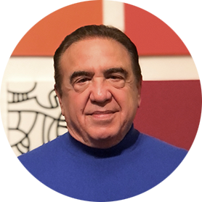
Faculty
Benjamin Levy, MD
Associate Professor, Johns Hopkins School of Medicine
Clinical Director
Medical Director, Thoracic Oncology Program
Johns Hopkins Sidney Kimmel Cancer Center
at Sibley Memorial
Washington, DC
MODERATOR
Neil Love, MD
Research To Practice
Miami, Florida

Slide 3
Commercial Support
This activity is supported by educational grants from AstraZeneca Pharmaceuticals LP and Genmab US Inc.

Slide 4
Dr Love — Disclosures
Dr Love is president and CEO of Research To Practice. Research To Practice receives funds in the form of educational grants to develop CME activities from the following companies: Aadi Bioscience, AbbVie Inc, ADC Therapeutics, Alexion Pharmaceuticals, Amgen Inc, Array BioPharma Inc, a subsidiary of Pfizer Inc, Arvinas, Astellas, AstraZeneca Pharmaceuticals LP, Aveo Pharmaceuticals, Bayer HealthCare Pharmaceuticals, BeiGene Ltd, Black Diamond Therapeutics Inc, Blueprint Medicines, Boehringer Ingelheim Pharmaceuticals Inc, Bristol Myers Squibb, Clovis Oncology, Coherus BioSciences, CTI BioPharma, a Sobi Company, Daiichi Sankyo Inc, Eisai Inc, Elevation Oncology Inc, Exact Sciences Corporation, Exelixis Inc, Genentech, a member of the Roche Group, Genmab US Inc, Geron Corporation, Gilead Sciences Inc, GSK, Hologic Inc, ImmunoGen Inc, Incyte Corporation, Ipsen Biopharmaceuticals Inc, Jazz Pharmaceuticals Inc, Johnson & Johnson, Karyopharm Therapeutics, Kite, A Gilead Company, Kura Oncology, Legend Biotech, Lilly, MEI Pharma Inc, Merck, Mersana Therapeutics Inc, Mirati Therapeutics Inc, Mural Oncology Inc, Natera Inc, Novartis, Novartis Pharmaceuticals Corporation on behalf of Advanced Accelerator Applications, Novocure Inc, Nuvalent, Pfizer Inc, Pharmacyclics LLC, an AbbVie Company, Puma Biotechnology Inc, Regeneron Pharmaceuticals Inc, Rigel Pharmaceuticals Inc, R-Pharm US, Sanofi, Seagen Inc, Servier Pharmaceuticals LLC, SpringWorks Therapeutics Inc, Stemline Therapeutics Inc, Syndax Pharmaceuticals, Taiho Oncology Inc, Takeda Pharmaceuticals USA Inc, TerSera Therapeutics LLC, and Tesaro, A GSK Company.

Slide 5
Research To Practice CME Planning Committee Members,
Staff and Reviewers
Planners, scientific staff and independent reviewers for Research To Practice have no relevant conflicts of interest to disclose.

Slide 6
Dr Levy — Disclosures
Advisory Committees and Consulting Agreements | Amgen Inc, AstraZeneca Pharmaceuticals LP, Daiichi Sankyo Inc, Genentech, a member of the Roche Group, Gilead Sciences Inc, Guardant Health, Janssen Biotech Inc, Jazz Pharmaceuticals Inc, Lilly, Merck, Mirati Therapeutics Inc, Pfizer Inc, Sanofi, Takeda Pharmaceuticals USA Inc

Slide 7
This educational activity contains discussion of
non-FDA-approved uses of agents and regimens. Please refer to official prescribing information for each product for approved indications.

Slide 8
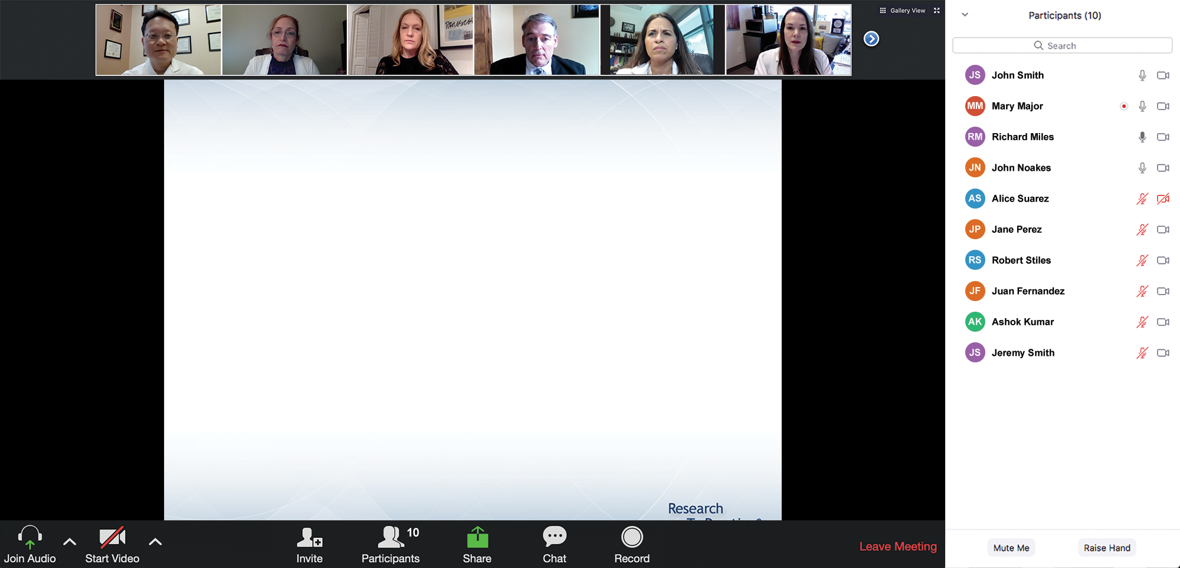
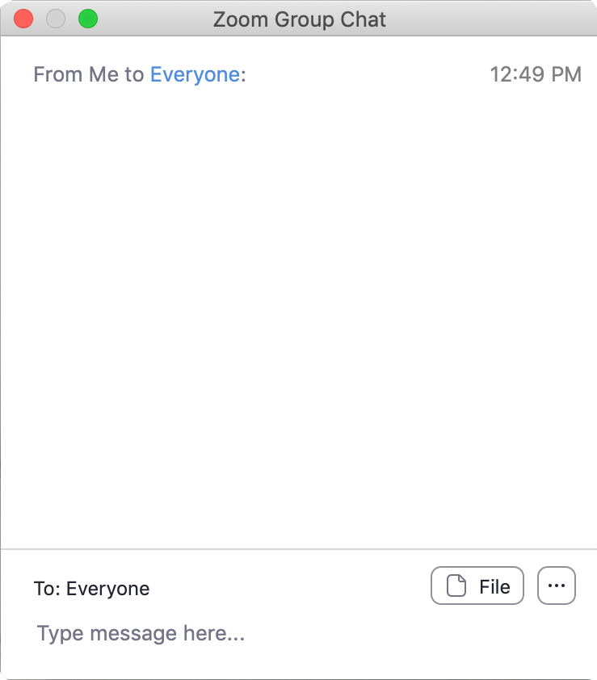
We Encourage Clinicians in Practice to Submit Questions
Feel free to submit questions now before the program begins and throughout the program.

Slide 9
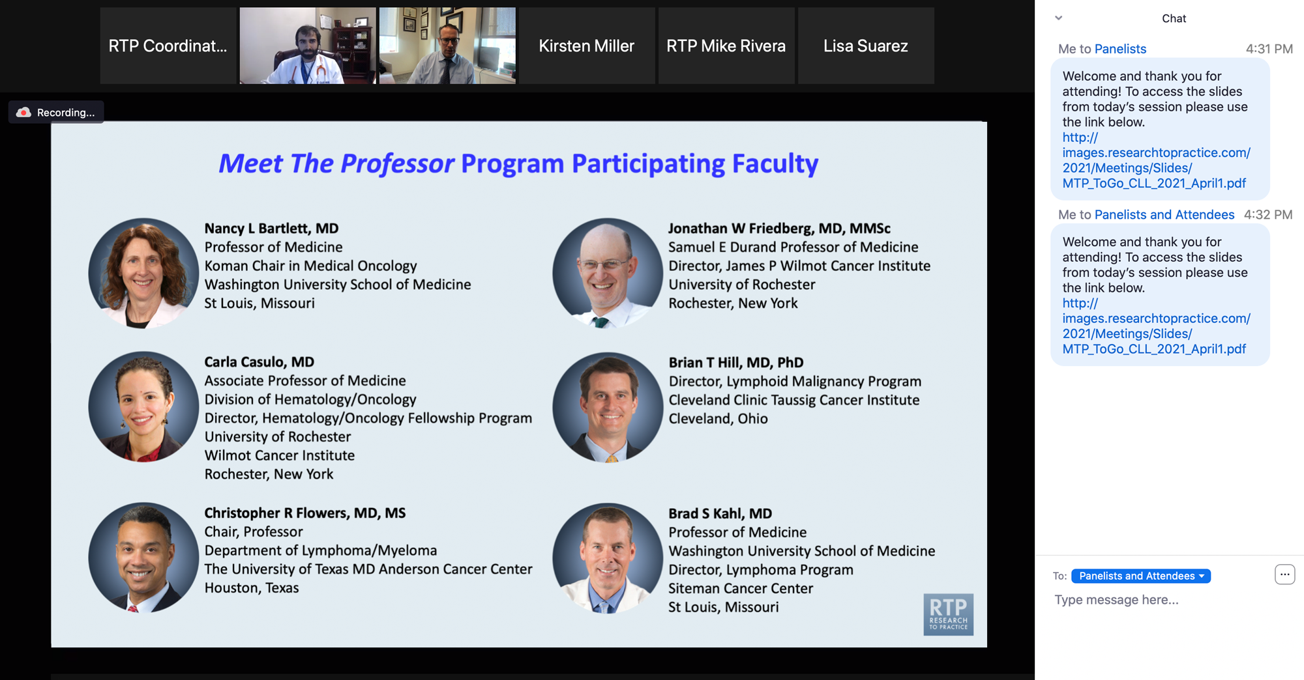
Familiarizing Yourself with the Zoom Interface
Expand chat submission box
Drag the white line above the submission box up to create
more space for your message.

Slide 10
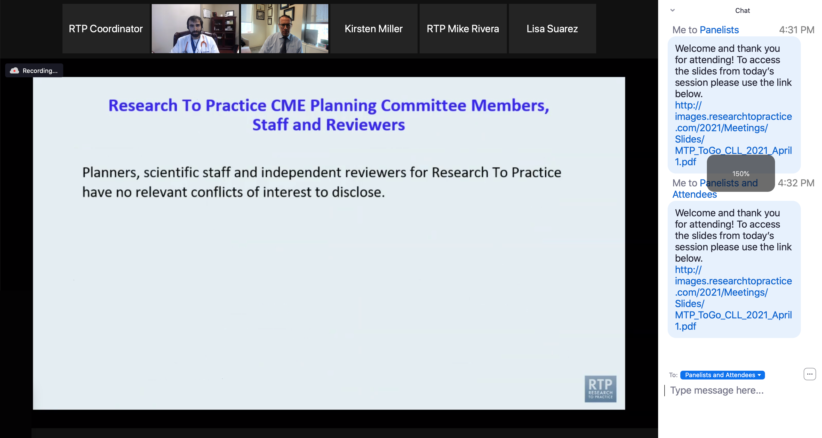
Familiarizing Yourself with the Zoom Interface
Increase chat font size
Press Command (for Mac) or Control (for PC) and the + symbol.
You may do this as many times as you need for readability.

Slide 11
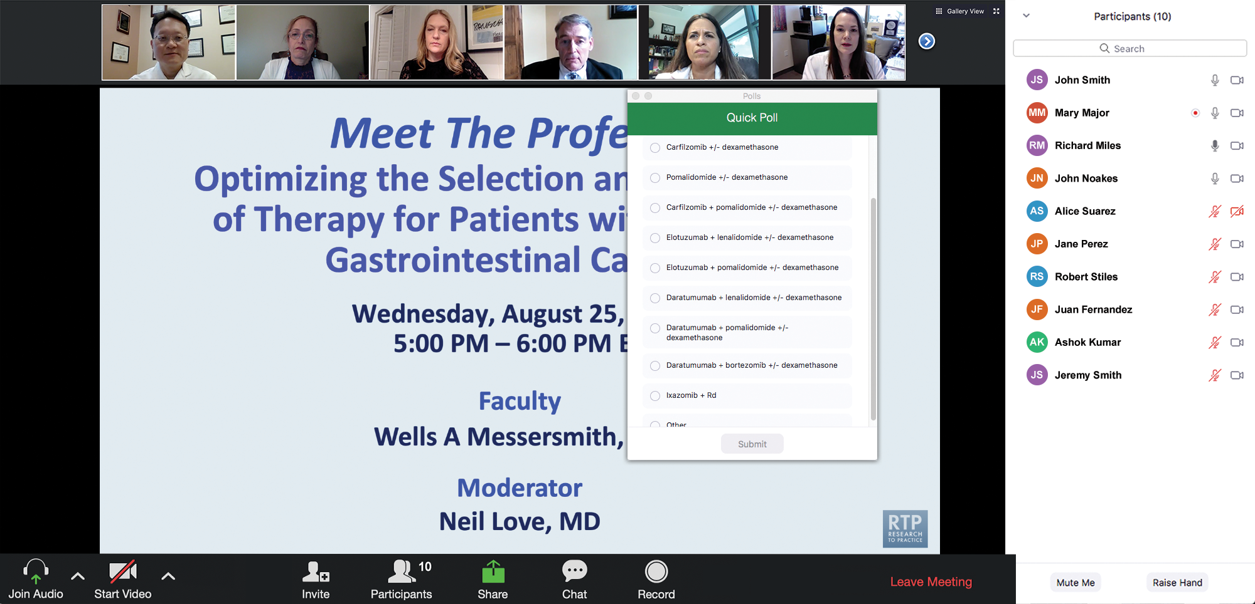
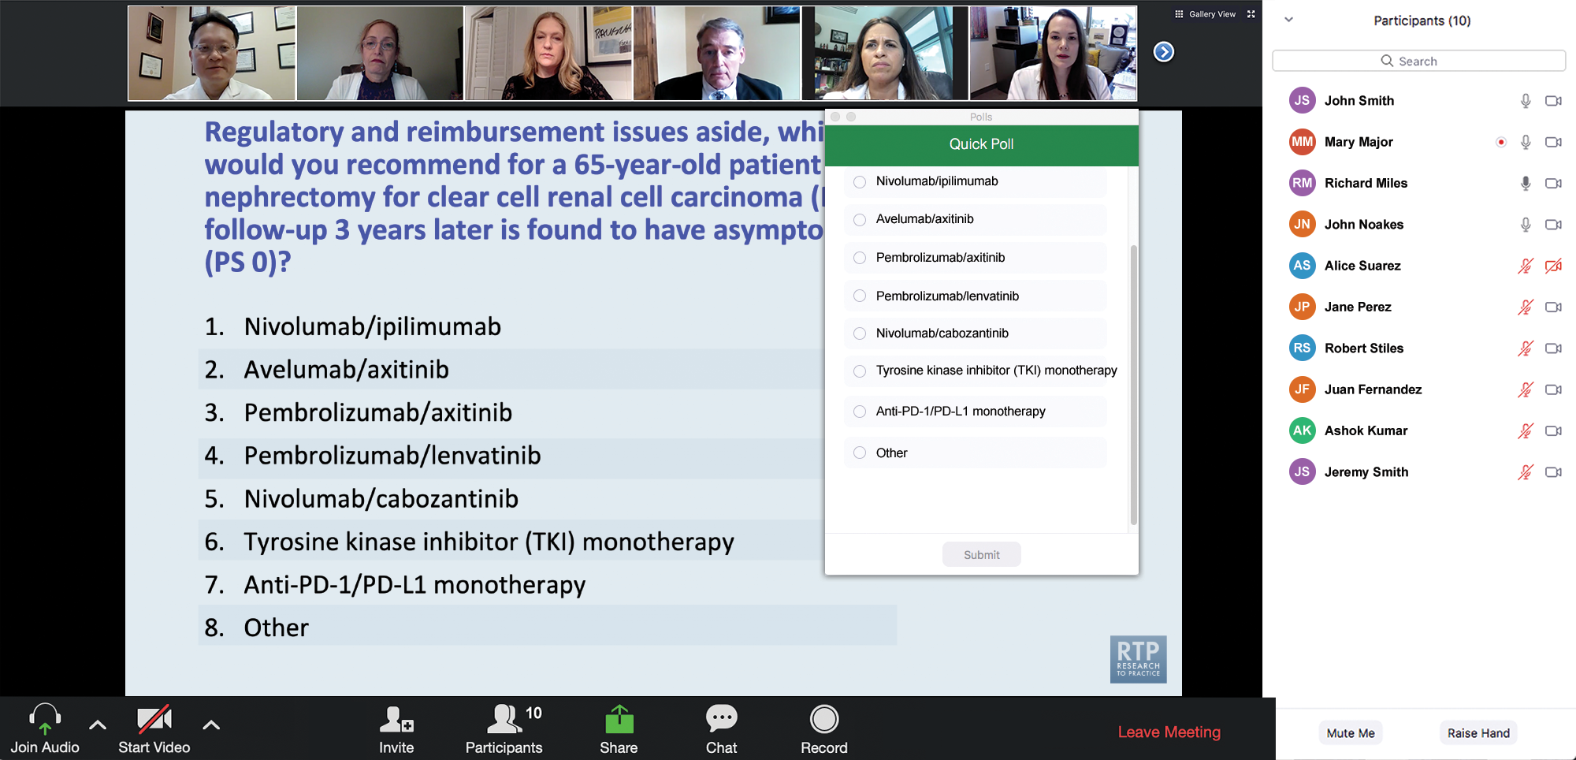
Clinicians in the Audience, Please Complete the Pre- and Postmeeting Surveys
Quick Survey
Quick Poll

Slide 12
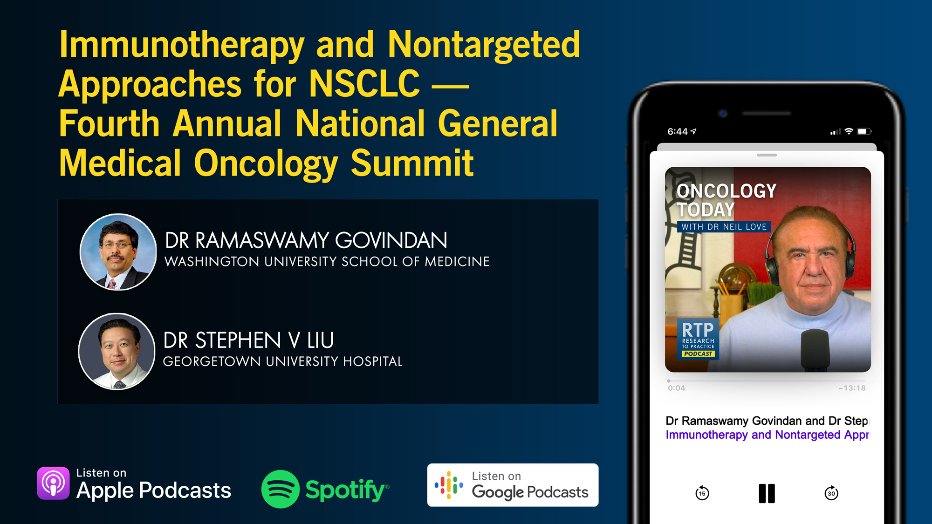

Slide 13
Optimizing the Selection of First-Line Therapy for Patients with Multiple Myeloma
A CME/MOC-Accredited Live Webinar
Tuesday,​ July 1, 2025
5:00 PM – 6:00 PM ET
Faculty
Xavier Leleu, MD, PhD
Peter Voorhees, MD
Moderator
Neil Love, MD

Slide 14
Practical Perspectives: Experts Review Actual Cases of Patients with Small Cell Lung Cancer
A CME/MOC-Accredited Live Webinar
Wednesday, July 16, 2025
5:00 PM – 6:00 PM ET
Faculty
Stephen V Liu, MD
Charles Rudin, MD, PhD
Moderator
Neil Love, MD

Slide 15
Cancer Q&A: Addressing Common Questions Posed by
Patients with Relapsed/Refractory Multiple Myeloma
A Webinar Series for Clinicians and Patients,
Developed in Partnership with CancerCare®
Patients
Clinicians
Wednesday, July 23, 2025
6:00 PM – 7:00 PM ET
Thursday, August 7, 2025
5:00 PM – 6:00 PM ET
Faculty
Natalie S Callander, MD
Sagar Lonial, MD, FACP
Moderator
Neil Love, MD

Slide 16
Year in Review:
Nontargeted Approaches for Lung Cancer
INTRODUCTION: The Boards
MODULE 1: Immune Checkpoint Inhibition for Localized Non-Small Cell Lung
Cancer (NSCLC)
MODULE 2: Immunotherapy for Metastatic NSCLC
MODULE 3: Antibody-Drug Conjugates
MODULE 4: Novel Bispecific Antibodies
MODULE 5: Journal Club with Dr Levy

Slide 17
Thank you for joining us!
Please take a moment to complete the survey currently up on Zoom.
Your feedback is very important to us.
Information on how to obtain CME, ABIM MOC and ABS credit will be provided in the Zoom chat room. Attendees will also receive an email in
1 to 3 business days with these instructions.

Slide 18
Year in Review:
Nontargeted Approaches for Lung Cancer
A CME/MOC-Accredited Live Webinar
Tuesday,​ June 24, 2025
5:00 PM – 6:00 PM ET
Faculty
Benjamin Levy, MD
Moderator
Neil Love, MD

Slide 19
Faculty
Benjamin Levy, MD
Associate Professor, Johns Hopkins School of Medicine
Clinical Director
Medical Director, Thoracic Oncology Program
Johns Hopkins Sidney Kimmel Cancer Center
at Sibley Memorial
Washington, DC
MODERATOR
Neil Love, MD
Research To Practice
Miami, Florida

Slide 20
We Encourage Clinicians in Practice to Submit Questions
Feel free to submit questions now before the program begins and throughout the program.

Slide 21
Clinicians in the Audience, Please Complete the Pre- and Postmeeting Surveys
Quick Survey
Quick Poll

Slide 23
Optimizing the Selection of First-Line Therapy for Patients with Multiple Myeloma
A CME/MOC-Accredited Live Webinar
Tuesday,​ July 1, 2025
5:00 PM – 6:00 PM ET
Faculty
Xavier Leleu, MD, PhD
Peter Voorhees, MD
Moderator
Neil Love, MD

Slide 24
Practical Perspectives: Experts Review Actual Cases of Patients with Small Cell Lung Cancer
A CME/MOC-Accredited Live Webinar
Wednesday, July 16, 2025
5:00 PM – 6:00 PM ET
Faculty
Stephen V Liu, MD
Charles Rudin, MD, PhD
Moderator
Neil Love, MD

Slide 25
Cancer Q&A: Addressing Common Questions Posed by
Patients with Relapsed/Refractory Multiple Myeloma
A Webinar Series for Clinicians and Patients,
Developed in Partnership with CancerCare®
Patients
Clinicians
Wednesday, July 23, 2025
6:00 PM – 7:00 PM ET
Thursday, August 7, 2025
5:00 PM – 6:00 PM ET
Faculty
Natalie S Callander, MD
Sagar Lonial, MD, FACP
Moderator
Neil Love, MD

Slide 26
Year in Review:
Nontargeted Approaches for Lung Cancer
A CME/MOC-Accredited Live Webinar
Tuesday,​ June 24, 2025
5:00 PM – 6:00 PM ET
Faculty
Benjamin Levy, MD
Moderator
Neil Love, MD

Slide 27
Commercial Support
This activity is supported by educational grants from AstraZeneca Pharmaceuticals LP and Genmab US Inc.
Research To Practice CME Planning Committee Members,
Staff and Reviewers
Planners, scientific staff and independent reviewers for Research To Practice have no relevant conflicts of interest to disclose.

Slide 28
Dr Levy — Disclosures
Advisory Committees and Consulting Agreements | Amgen Inc, AstraZeneca Pharmaceuticals LP, Daiichi Sankyo Inc, Genentech, a member of the Roche Group, Gilead Sciences Inc, Guardant Health, Janssen Biotech Inc, Jazz Pharmaceuticals Inc, Lilly, Merck, Mirati Therapeutics Inc, Pfizer Inc, Sanofi, Takeda Pharmaceuticals USA Inc

Slide 29
This educational activity contains discussion of
non-FDA-approved uses of agents and regimens. Please refer to official prescribing information for each product for approved indications.

Slide 30
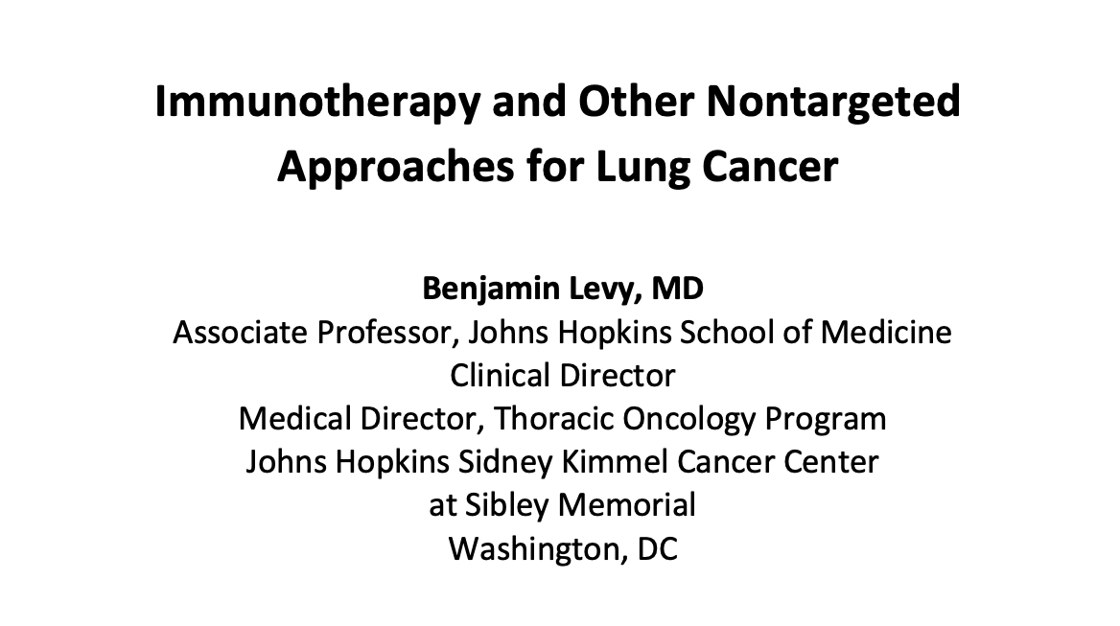

Slide 31
Key Datasets
Benjamin Levy, MD
Forde PM et al. Overall survival with neoadjuvant nivolumab (NIVO) + chemotherapy (chemo) in patients with resectable NSCLC in CheckMate 816. ASCO 2025;Abstract LBA8000.
Heymach JV et al. Perioperative durvalumab for resectable NSCLC (R-NSCLC): Updated outcomes from the Phase 3 AEGEAN trial. WCLC 2024;Abstract OA13.03.
Spicer JD et al. Neoadjuvant pembrolizumab plus chemotherapy followed by adjuvant pembrolizumab compared with neoadjuvant chemotherapy alone in patients with early-stage non-small-cell lung cancer (KEYNOTE-671): A randomised, double-blind, placebo-controlled, phase 3 trial. Lancet 2024;404(10459):1240-52.
Provencio M et al. Perioperative nivolumab (NIVO) vs placebo (PBO) in patients (pts) with resectable NSCLC: Updated survival and biomarker analyses from CheckMate 77T. ASCO 2025;Abstract LBA8010.
Filippi AR et al. Real-world 5-year survival outcomes with durvalumab (D) after chemoradiotherapy (CRT) in unresectable, stage III NSCLC (urNSCLC): Final data extraction from PACIFIC-R. ELCC 2025;Abstract 190P.
Reck M et al. Five-year outcomes with first-line nivolumab plus ipilimumab with 2 cycles of chemotherapy versus 4 cycles of chemotherapy alone in patients with metastatic non-small cell lung cancer in the randomized CheckMate 9LA trial. Eur J Cancer 2024;211:114296.
Peters S et al. Durvalumab with or without tremelimumab in combination with chemotherapy in first-line metastatic NSCLC: Five-year overall survival outcomes from the phase 3 POSEIDON trial.
J Thorac Oncol 2025;20(1):76-93.

Slide 32
Key Datasets
Benjamin Levy, MD (continued)
Garassino MC et al. Normalized membrane ratio of TROP2 by quantitative continuous scoring is predictive
of clinical outcomes in TROPION-Lung 01. WCLC 2024;Abstract PL02.11.
Levy BP et al. TROPION-Lung02: Datopotamab deruxtecan (Dato-DXd) plus pembrolizumab (pembro) with
or without platinum chemotherapy (Pt-CT) as first-line (1L) therapy for advanced non-small cell lung cancer (aNSCLC). ASCO 2025;Abstract 8501.
Xiong A et al. Ivonescimab versus pembrolizumab for PD-L1-positive non-small cell lung cancer (HARMONi-2): A randomised, double-blind, phase 3 study in China. Lancet 2025;405(10481):839-49.
Aerts J et al. Acasunlimab (DuoBody-PD-L1x4-1BB) alone or in combination with pembrolizumab (pembro)
in patients (pts) with previously treated metastatic non-small cell lung cancer (mNSCLC): Initial results of a randomized, open-label, phase 2 trial. ASCO 2024;Abstract 2533.
Paz-Ares L et al. ABBIL1TY NSCLC-06: A global, randomized, open-label, phase III trial of acasunlimab in combination with pembrolizumab (pembro) vs docetaxel in checkpoint inhibitor (CPI)-experienced patients with PD-L1+ metastatic non-small cell lung cancer (mNSCLC). ELCC 2025;Abstract 128TiP.
Mamdani H. Bispecific antibodies in action: Engineering immunity to target thoracic malignancies. ASCO 2025 Clinical Science Symposium.

Slide 33
Year in Review:
Nontargeted Approaches for Lung Cancer
INTRODUCTION: The Boards
MODULE 1: Immune Checkpoint Inhibition for Localized Non-Small Cell Lung
Cancer (NSCLC)
MODULE 2: Immunotherapy for Metastatic NSCLC
MODULE 3: Antibody-Drug Conjugates
MODULE 4: Novel Bispecific Antibodies
MODULE 5: Journal Club with Dr Levy

Slide 34
Year in Review:
Nontargeted Approaches for Lung Cancer
INTRODUCTION: The Boards
MODULE 1: Immune Checkpoint Inhibition for Localized Non-Small Cell Lung
Cancer (NSCLC)
MODULE 2: Immunotherapy for Metastatic NSCLC
MODULE 3: Antibody-Drug Conjugates
MODULE 4: Novel Bispecific Antibodies
MODULE 5: Journal Club with Dr Levy

Slide 35
Superior vena cava syndrome

Slide 36
Metastatic NSCLC with no actionable mutation and a PD-L1 TPS (tumor proportion score) between 1% and 50%

Slide 37
Metastatic NSCLC with an activating
EGFR mutation and brain metastases

Slide 38
FDA Grants Accelerated Approval to Datopotamab Deruxtecan-dlnk for EGFR-Mutated NSCLC
Press Release: June 23, 2025
“On June 23, 2025, the Food and Drug Administration granted accelerated approval to datopotamab deruxtecan-dlnk for adults with locally advanced or metastatic epidermal growth factor receptor (EGFR)-mutated non-small cell lung cancer (NSCLC) who have received prior EGFR-directed therapy and platinum-based chemotherapy.
Efficacy was evaluated in a pooled subgroup of 114 patients with locally advanced or metastatic EGFR-mutated NSCLC who had received prior treatment with an EGFR-directed therapy and platinum-based chemotherapy and received datopotamab deruxtecan-dlnk at the recommended dose across two clinical trials: TROPION-Lung05 and TROPION-Lung01. TROPION-Lung05 (NCT04484142) was a multicenter, single-arm trial, while TROPION-Lung01 (NCT04656652) was a multicenter, open-label, randomized controlled trial.
The recommended datopotamab deruxtecan-dlnk dose is 6 mg/kg (up to a maximum of 540 mg for patients
≥ 90 kg), as an intravenous infusion once every 3 weeks, until disease progression or unacceptable toxicity.”
https://www.fda.gov/drugs/resources-information-approved-drugs/fda-grants-accelerated-approval-datopotamab-deruxtecan-dlnk-egfr-mutated-non-small-cell-lung-cancer

Slide 39
Year in Review:
Nontargeted Approaches for Lung Cancer
INTRODUCTION: The Boards
MODULE 1: Immune Checkpoint Inhibition for Localized Non-Small Cell Lung
Cancer (NSCLC)
MODULE 2: Immunotherapy for Metastatic NSCLC
MODULE 3: Antibody-Drug Conjugates
MODULE 4: Novel Bispecific Antibodies
MODULE 5: Journal Club with Dr Levy

Slide 40
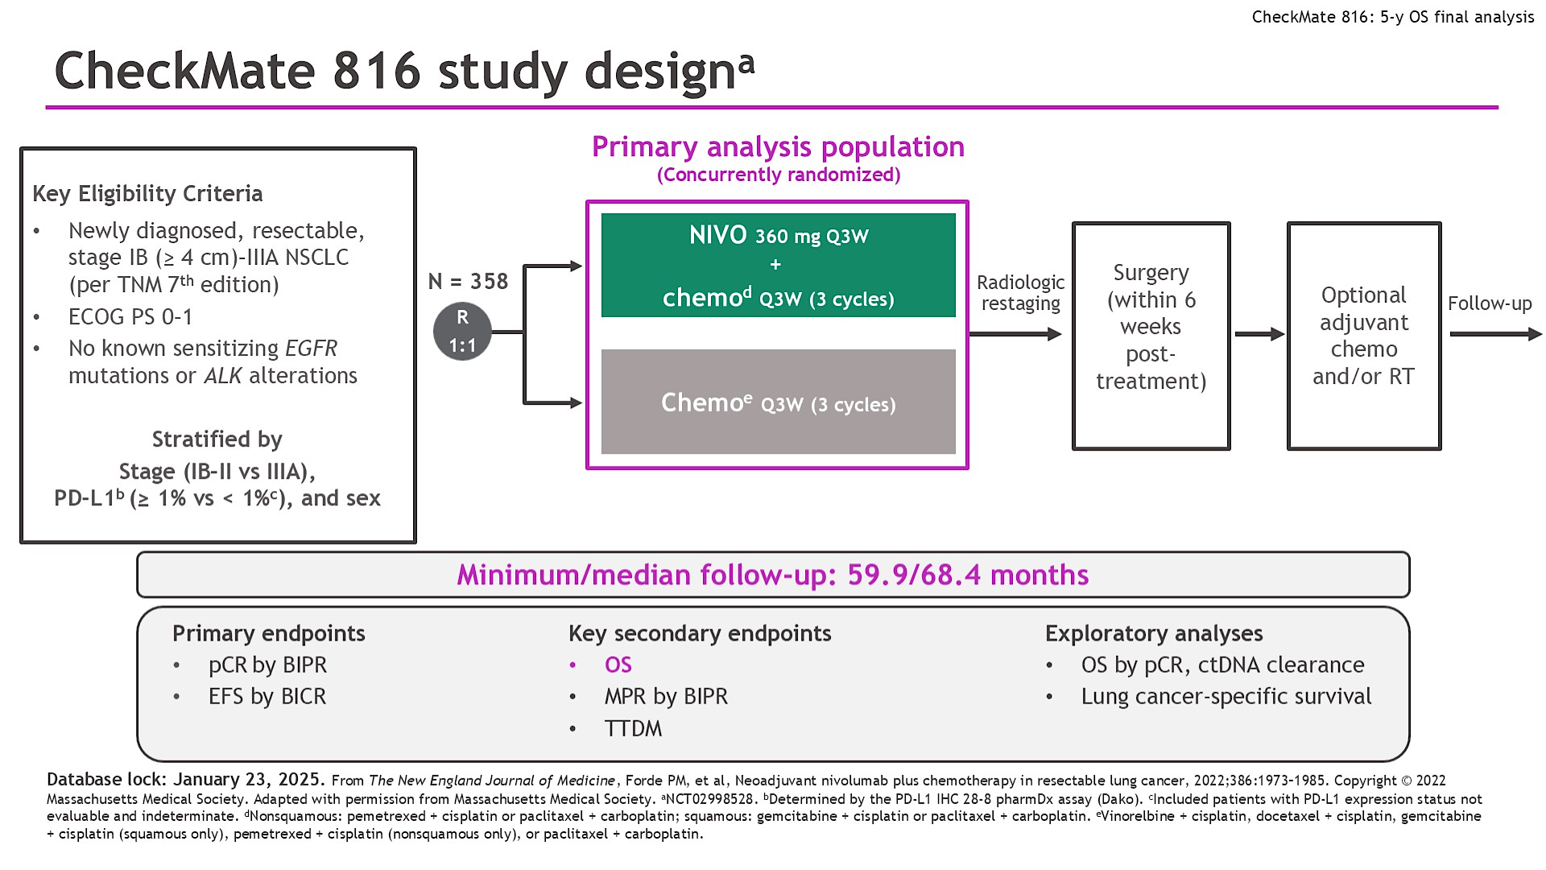
CheckMate 816 study designa
Frode ASCO 2025;Abstract LBA8000

Slide 41
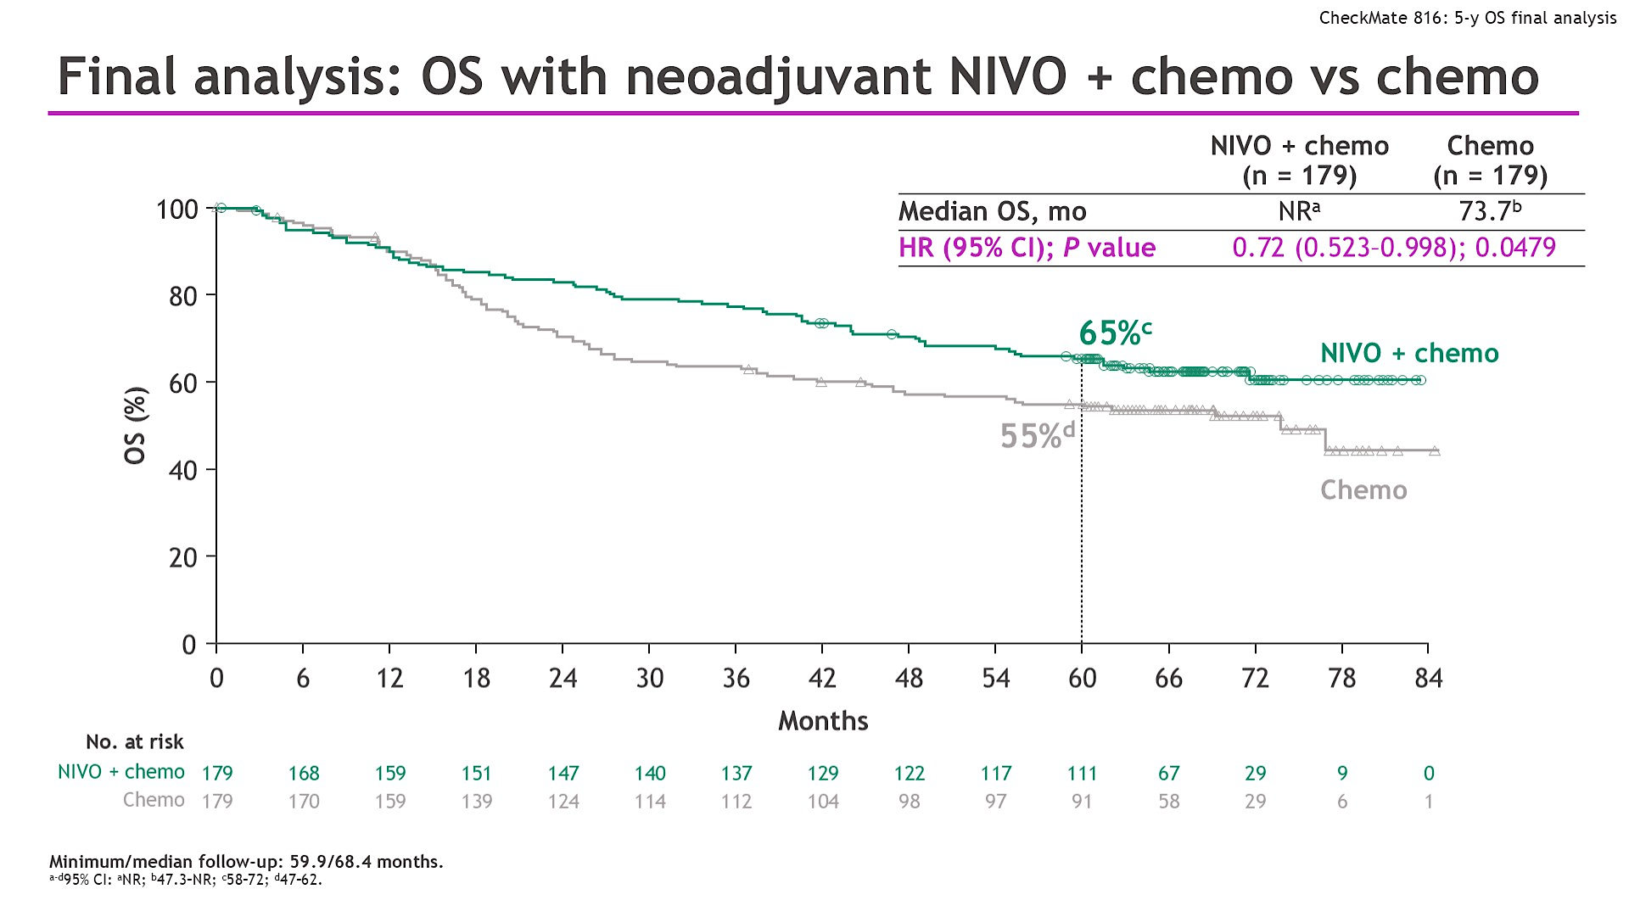
Final analysis: OS with neoadjuvant NIVO + chemo vs chemo
Frode ASCO 2025;Abstract LBA8000

Slide 42
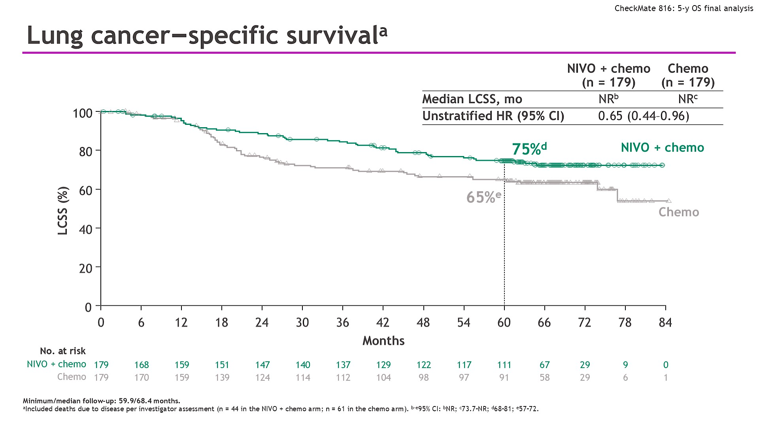
Lung cancer–specific survivala
Frode ASCO 2025;Abstract LBA8000

Slide 43
AEGEAN: A phase 3, global, randomized, double-blind, placebo-controlled study
Study population
Treatment-naïve
ECOG PS 0 or 1
Resectable NSCLC*
(stage IIA–IIIB[N2]; AJCC 8th ed)
Lobectomy, sleeve resection, or bilobectomy as planned surgery*
Confirmed PD-L1 status†
No documented EGFR/ALK
aberrations*
    Durvalumab 1500 mg IV +
    platinum-based CT‡
    Q3W for 4 cycles
Durvalumab 1500 mg IV
Q4W for 12 cycles
Surgery §
Randomization stratified by:
Disease stage (II vs III)
PD-L1 expression (≥1% vs <1%)
R
1:1
    Placebo IV +
    platinum-based CT‡
    Q3W for 4 cycles
Placebo IV
Q4W for 12 cycles
Surgery §
N=802 randomized
Endpoints: All efficacy analyses performed on a modified population that excludes patients with documented EGFR/ALK aberrations¶
Primary: pCR by central lab (per IASLC 2020¹) EFS using BICR (per RECIST v1.1) | Key secondary: MPR by central lab (per IASLC 2020¹) DFS using BICR (per RECIST v1.1) OS
*The protocol was amended while enrollment was ongoing to exclude (1) patients with tumors classified as T4 for any reason other than size; (2) patients with planned pneumonectomies; and (3) patients with documented EGFR/ALK aberrations. †Ventana SP263 immunohistochemistry assay. ‡Choice of CT regimen determined by histology and at the investigator’s discretion. For non-squamous: cisplatin + pemetrexed or carboplatin + pemetrexed. For squamous: carboplatin + paclitaxel
or cisplatin + gemcitabine (or carboplatin + gemcitabine for patients who have comorbidities or who are unable to tolerate cisplatin per the investigator’s judgment). §Post-operative radiotherapy (PORT) was permitted where indicated per local guidance. ¶All efficacy analyses reported in this presentation were performed on the mITT population, which includes all randomized patients who did not have documented EGFR/ALK aberrations. AJCC, American Joint Committee on Cancer; BICR, blinded independent central review; DFS, disease-free survival; EFS, event-free survival; mITT, modified intent-to-treat; MPR, major pathologic response; pCR, pathologic complete response.
¹Travis WD, et al. J Thorac Oncol 2020;15:709-40.

Slide 44
AEGEAN: Pathologic response per IASLC 2020 methodology* (mITT)
Final analysis
pCR (central lab)
MPR (central lab)
Difference = 21.0%
(95% CI: 15.1–26.9)†
Difference = 13.0%
(95% CI: 8.7–17.6)†
P-value = 0.000002
based on interim
analysis (n=402)‡
pCR rate (%)
MPR rate (%)
P-value = 0.000036
based on interim
analysis (n=402)‡
D arm
(N=366)
PBO arm
(N=374)
D arm
(N=366)
PBO arm
(N=374)
Heymach AACR 2023; Abstract CT005
*Using IASLC recommendations for pathologic assessment of response to therapy, including gross assessment and processing of tumor bed (Travis WD, et al. J Thorac Oncol 2020;15:709-40). pCR = a lack of any viable tumor cells after complete evaluation of the resected lung cancer specimen
and all sampled regional lymph nodes. MPR = less than or equal to 10% viable tumor cells in lung primary tumor after complete evaluation of the resected lung cancer specimen. To be eligible for pathologic assessment, patients needed to have received three cycles of neoadjuvant study Tx per protocol. Patients who were not evaluable were classified as non-responders. †CIs calculated by stratified Miettinen and Nurminen method. ‡No formal statistical testing was performed at the pCR final analysis (DCO: Nov 10, 2022; n=740 [data shown]). Statistical significance was achieved at the interim pCR analysis (DCO: Jan 14, 2022; n=402; P-value for pCR/MPR calculated using a stratified Cochran-Mantel-Haenszel test with a significance boundary = 0.000082 calculated using a Lan-DeMets alpha spending function with O'Brien Fleming boundary).

Slide 45
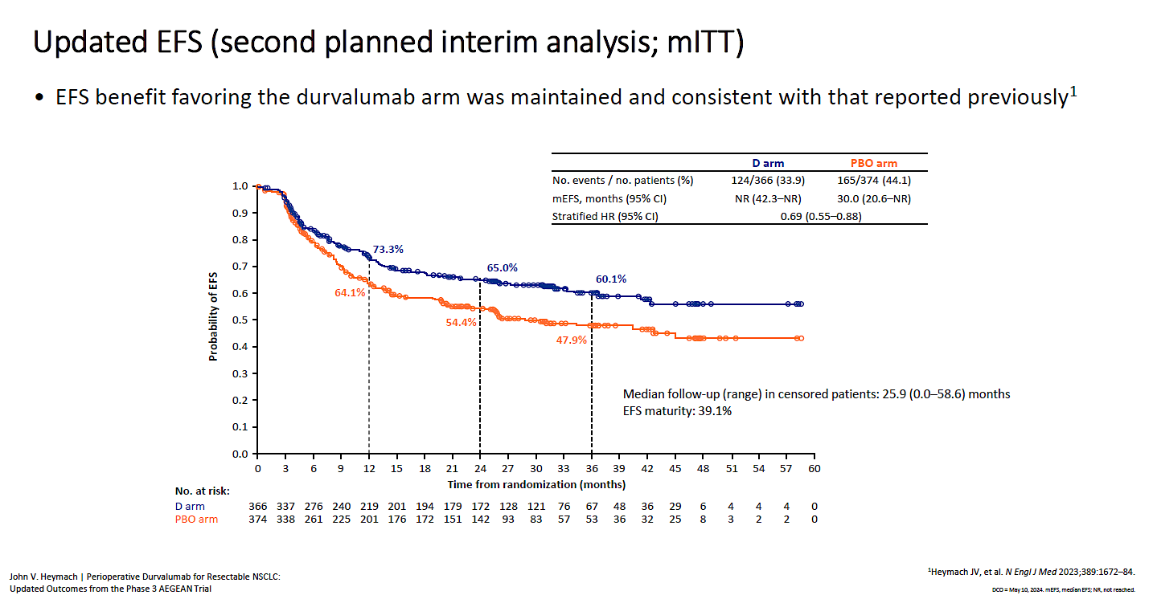
AEGEAN: Updated Event Free Survival

Slide 46
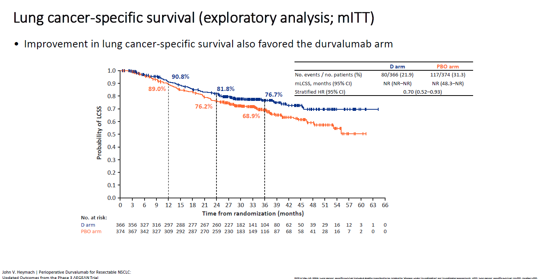
AEGEAN: Updated Overall Survival

Slide 47
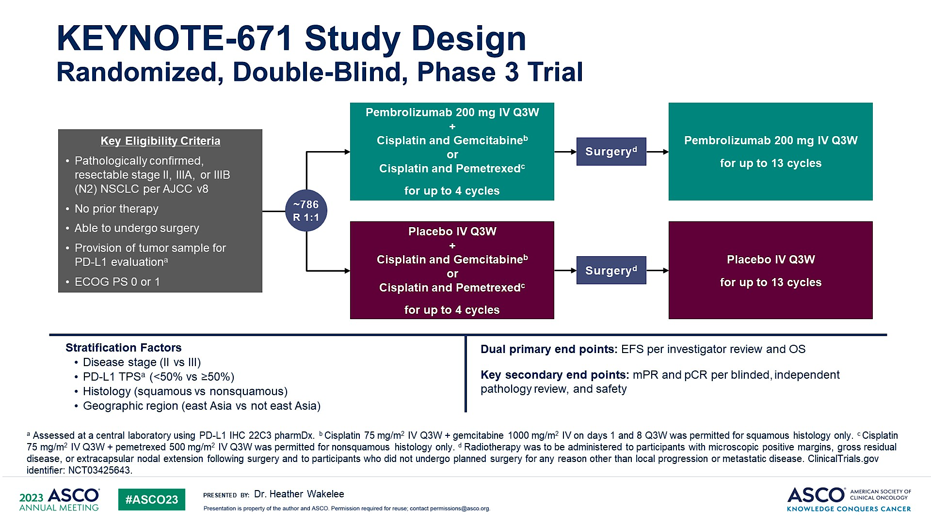
KEYNOTE-671 Study Design<br />Randomized, Double-Blind, Phase 3 Trial
Wakelee ASCO 2023; Abstract LBA1000

Slide 48
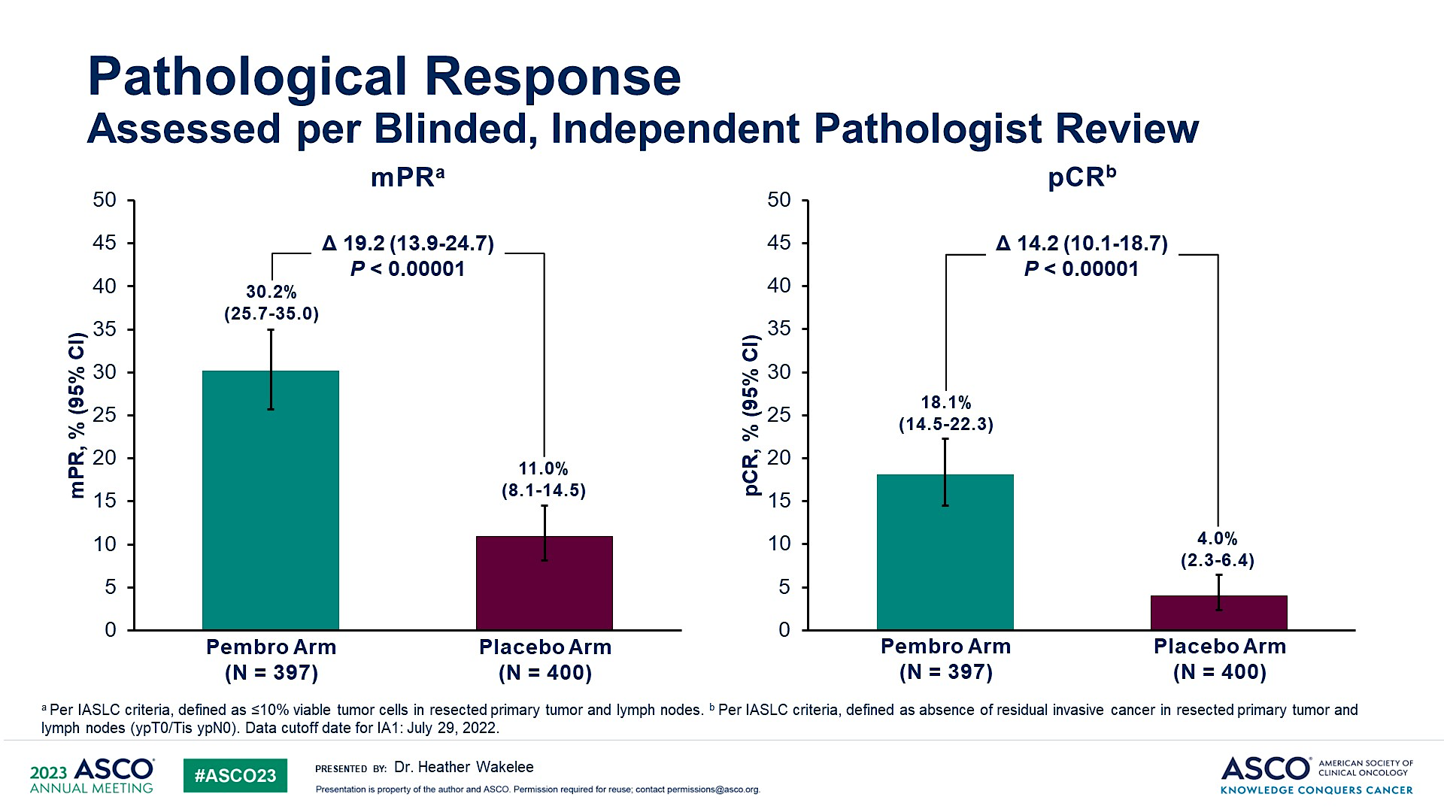
Pathological Response<br />Assessed per Blinded, Independent Pathologist Review
KEYNOTE-671
Wakelee ASCO 2023; Abstract LBA1000

Slide 49
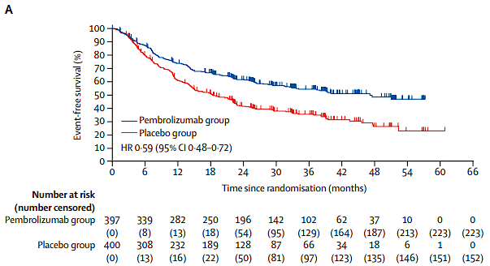
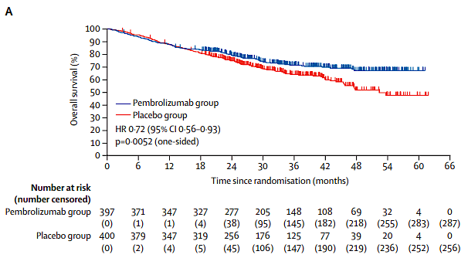
KEYNOTE-671: Updated Overall Survival
Event Free Survival
Overall Survival

Slide 50
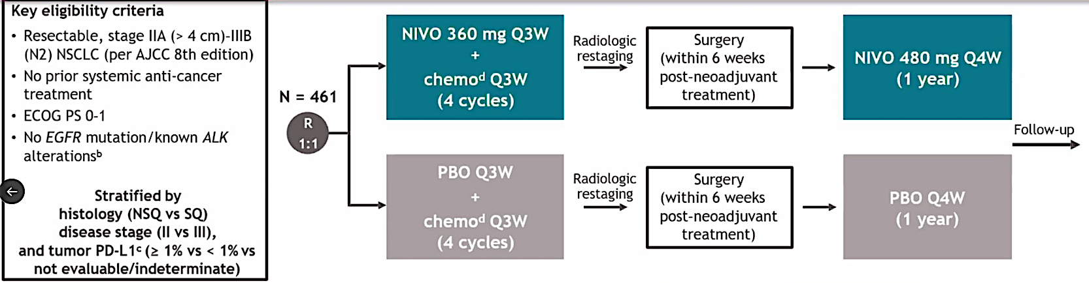
CHECKMATE-77T
Cascone ESMO 2023; Abstract LBA1

Slide 51
OS and lung cancer–specific survival
OS
Lung cancer–specific survival^{d}
 | NIVO (n = 229) | PBO (n = 232)
Median OS, mo (95% CI) | NR (NR–NR) | NR (NR–NR)
HR (97.63% CI)ª | 0.85 (0.58–1.25) | 0.97 (0.83–1.15)
 | NIVO (n = 229) | PBO (n = 232)
Median lung cancer–specific survival, mo (95% CI) | NR (NR–NR) | NR (NR–NR)
HR (95% CI) | 0.60 (0.40–0.89) | 0.97 (0.83–1.15)
100
100
89%
87%^{e}
80%
78%^{b}
NIVO
80
NIVO
80
80%
77%
72%^{c}
75%^{f}
60
60
PBO
OS (%)
PBO
Lung cancer–specific survival (%)
40
40
20
20
0
0
0
6
12
18
24
30
36
42
48
54
60
0
6
12
18
24
30
36
42
48
54
60
Months from randomization
Months from randomization
No. at risk
NIVO
229
206
187
176
166
161
114
66
23
6
0
229
206
187
176
166
161
114
66
23
6
0
PBO
232
216
197
178
161
152
103
52
20
7
0
232
216
197
178
161
152
103
52
20
7
0
Median follow-up (range): 41.0 months (31.3–59.8).
67 (29%) patients in the NIVO arm and 101 (44%) patients in the PBO arm received subsequent therapy of any type; 50 (22%) and 87 (38%) patients, respectively, received subsequent systemic therapy.
ªHR (95% CI), 0.85 (0.61–1.18). Significance boundary for OS was not met at this interim analysis. ^{b,c}95% CI: ^{b}72–83; ^{c}66–78. ^{d}Exploratory analysis; events were deaths with noted reason of “disease” per investigator assessment. ^{e,f}95% CI: ^{e}82–91; ^{f}69–81.
Provencio ASCO 2025;Abstract LBA8010

Slide 52
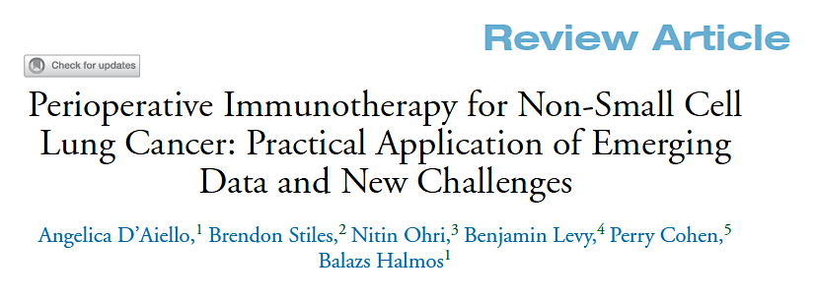

Clin Lung Cancer 2024;25(3):197-214.

Slide 53
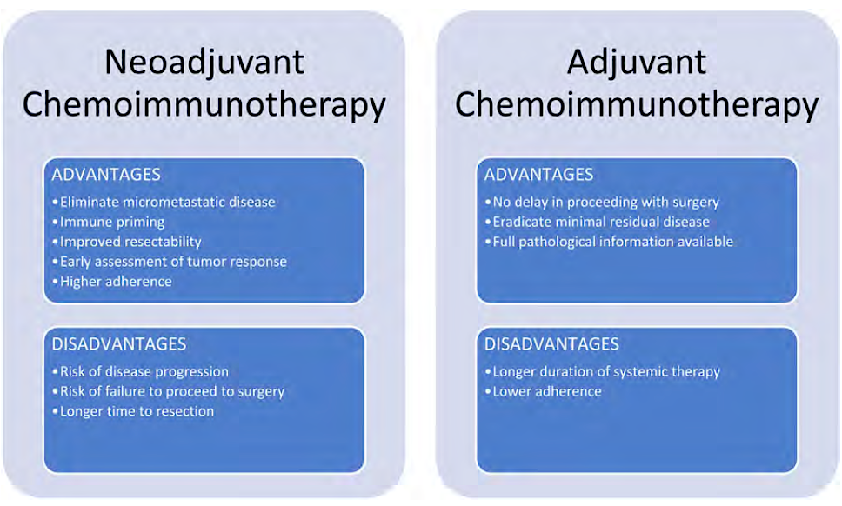
Neoadjuvant and Adjuvant Advantages and Disadvantages
D’Aiello A et al. Clin Lung Cancer 2024;25(3):197-214.

Slide 54
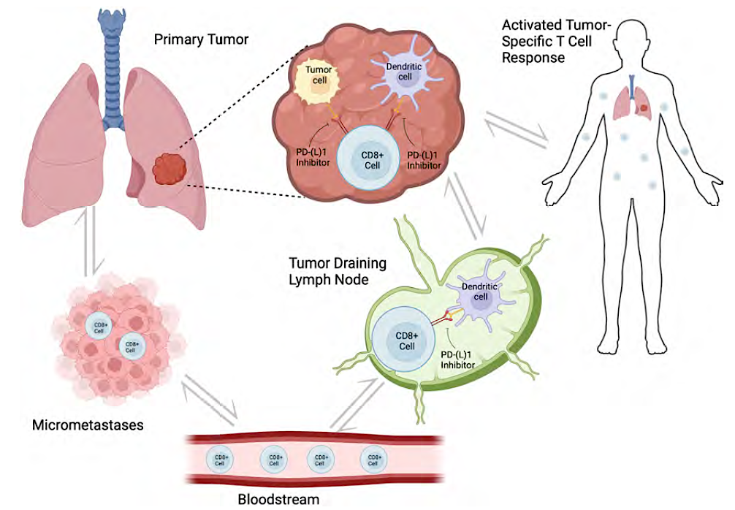
Neoadjuvant Biology
D’Aiello A et al. Clin Lung Cancer 2024;25(3):197-214.

Slide 55
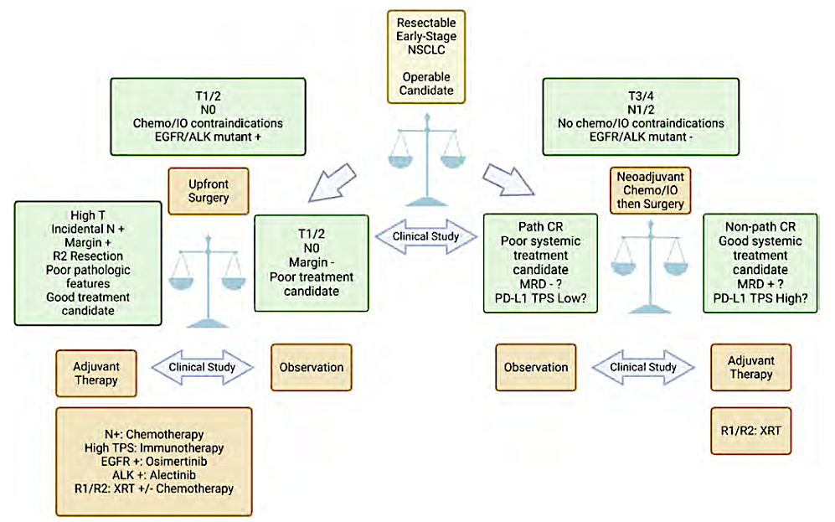
Practical Implementation and Patient Navigation for Perioperative Immunotherapy in NSCLC
D’Aiello A et al. Clin Lung Cancer 2024;25(3):197-214.

Slide 56
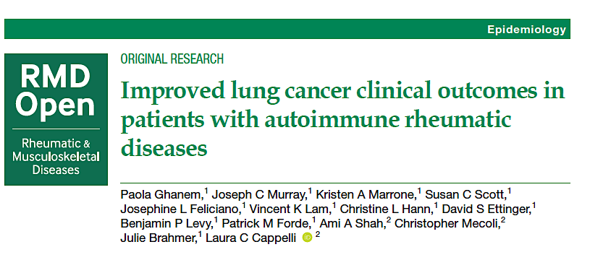
2023;9(4):e003471.

Slide 57
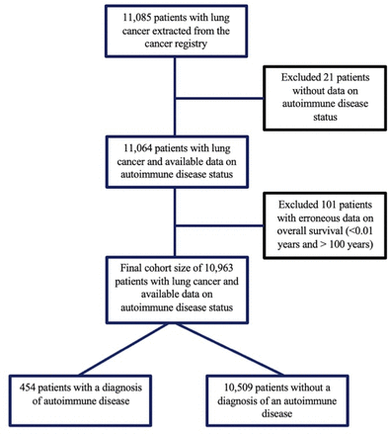
Flow Diagram of Cohort Selection
Ghanem P et al. RMD Open 2023;9(4):e003471.

Slide 58
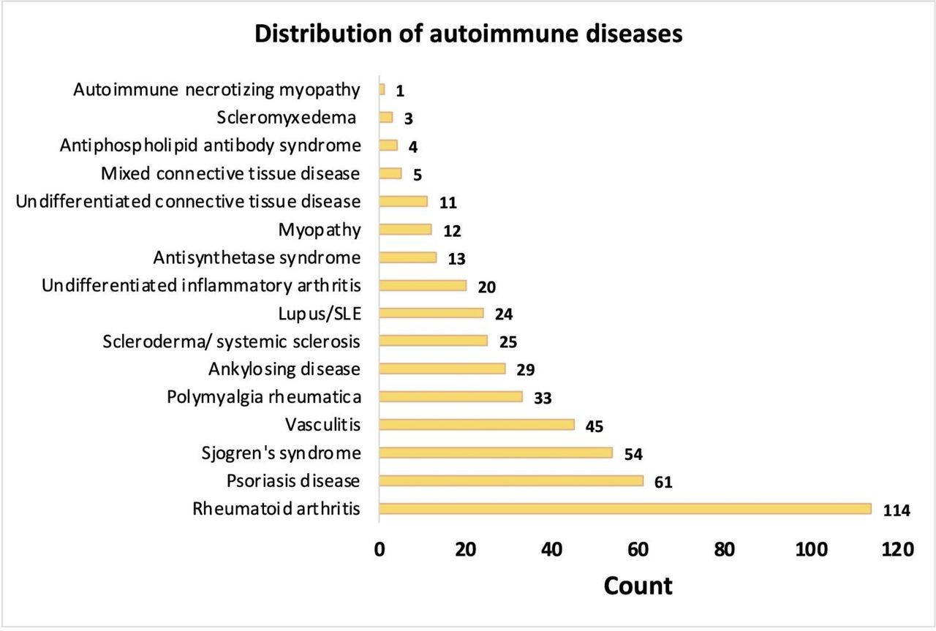
Distribution of Autoimmune Diseases
Ghanem P et al. RMD Open 2023;9(4):e003471.

Slide 59
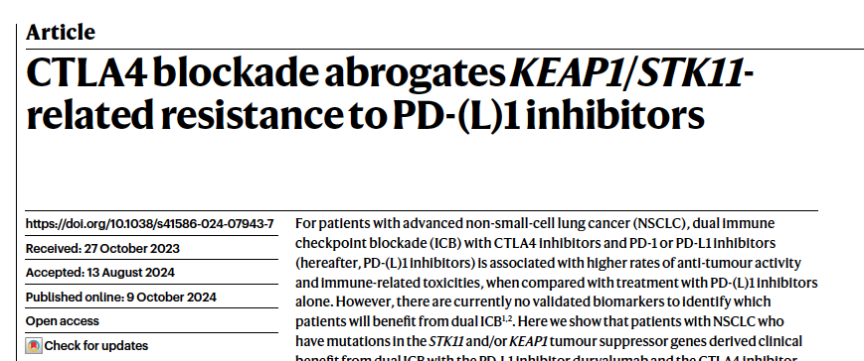
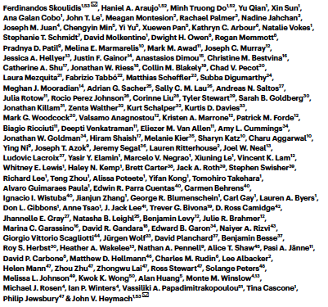
Nature 2024;635(8038):462-71.

Slide 60
PACIFIC: 5 YEAR OUTCOMES
Spigel et al. JCO 2022

Slide 61

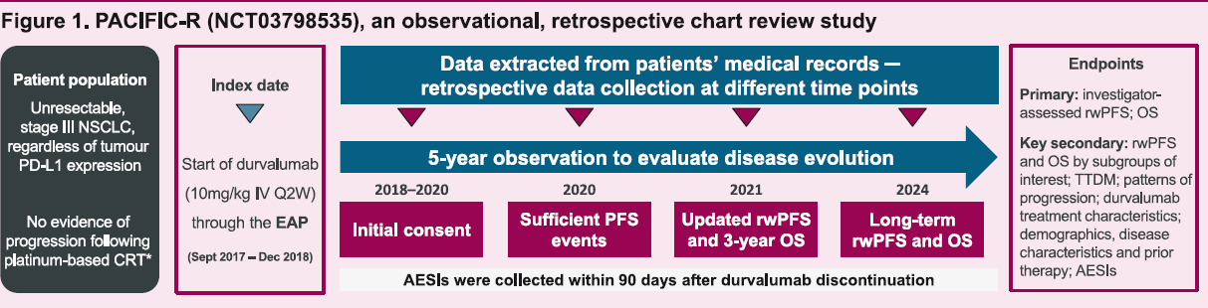
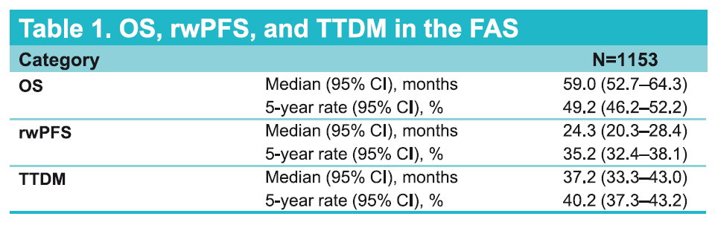
No evidence of
progression following
platinum-based CRT*
Filippi ELCC 2025;Abstract 190P

Slide 62
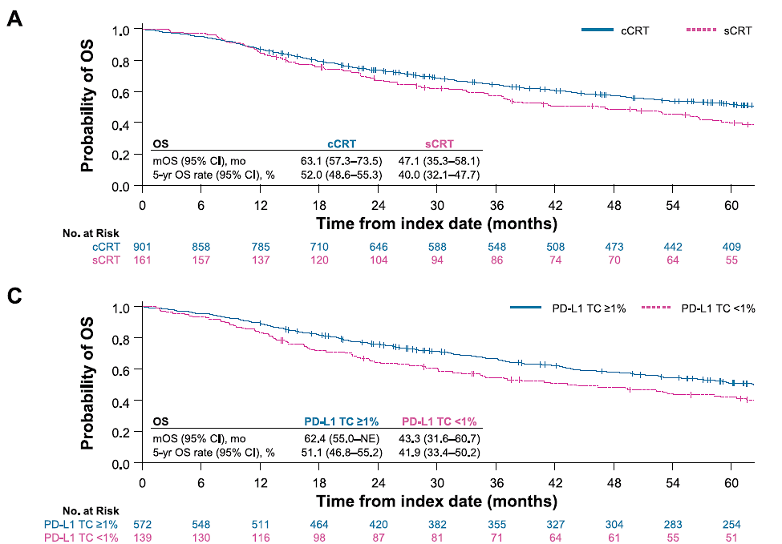
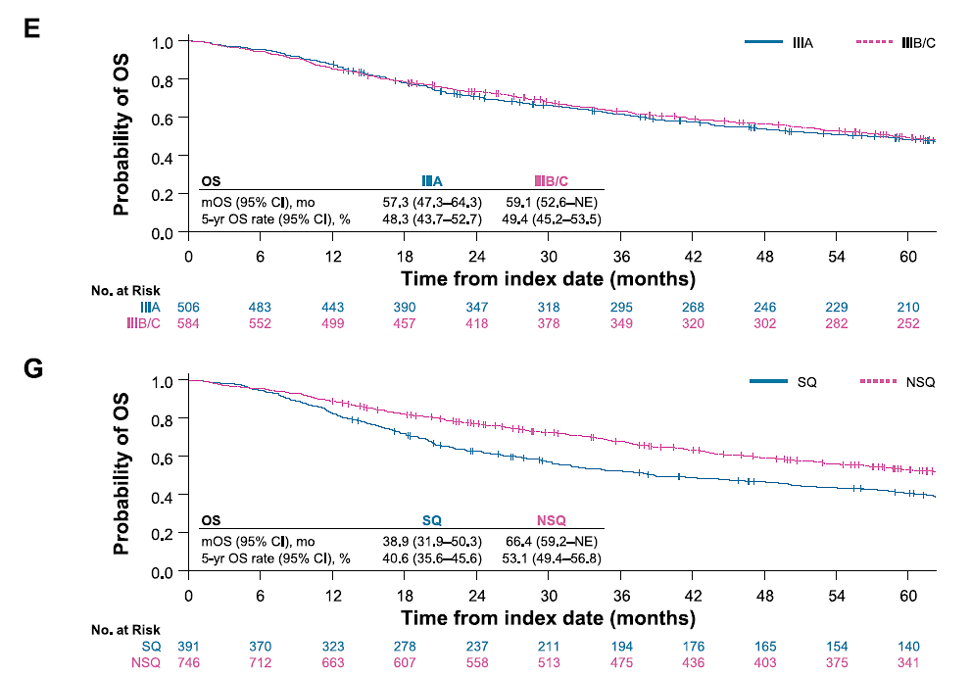
PACIFIC-RW OUTCOMES
Filippi ELCC 2025;Abstract 190P

Slide 63
QUESTIONS?

Slide 64
Year in Review:
Nontargeted Approaches for Lung Cancer
INTRODUCTION: The Boards
MODULE 1: Immune Checkpoint Inhibition for Localized Non-Small Cell Lung
Cancer (NSCLC)
MODULE 2: Immunotherapy for Metastatic NSCLC
MODULE 3: Antibody-Drug Conjugates
MODULE 4: Novel Bispecific Antibodies
MODULE 5: Journal Club with Dr Levy

Slide 65
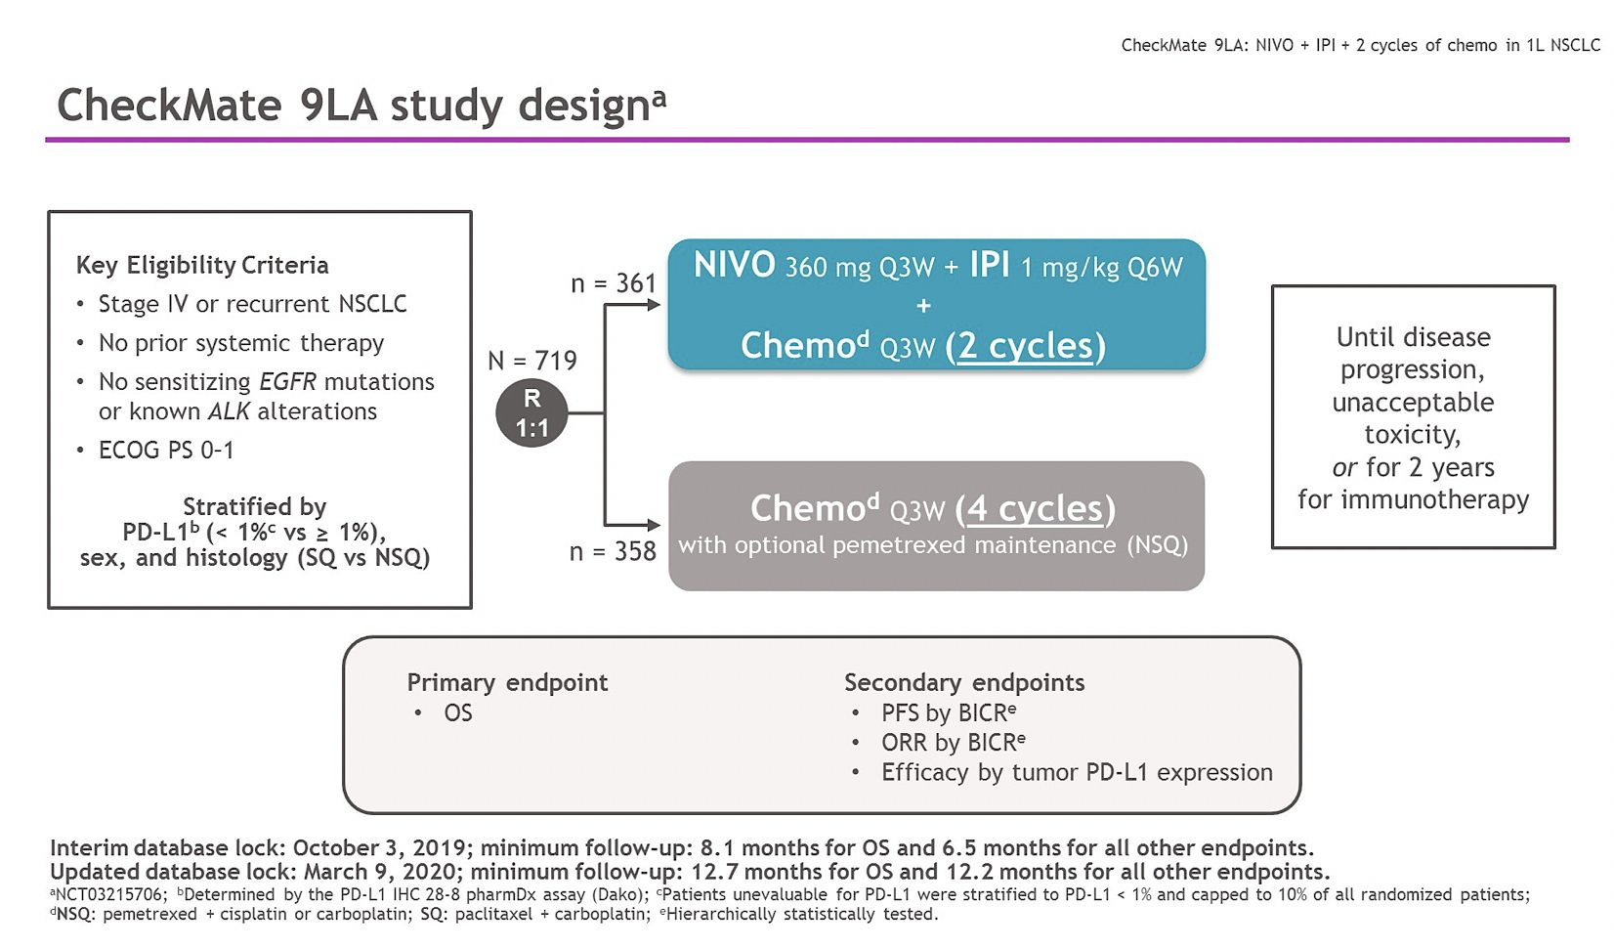
Reck ASCO 2024;Abstract 8560

Slide 66
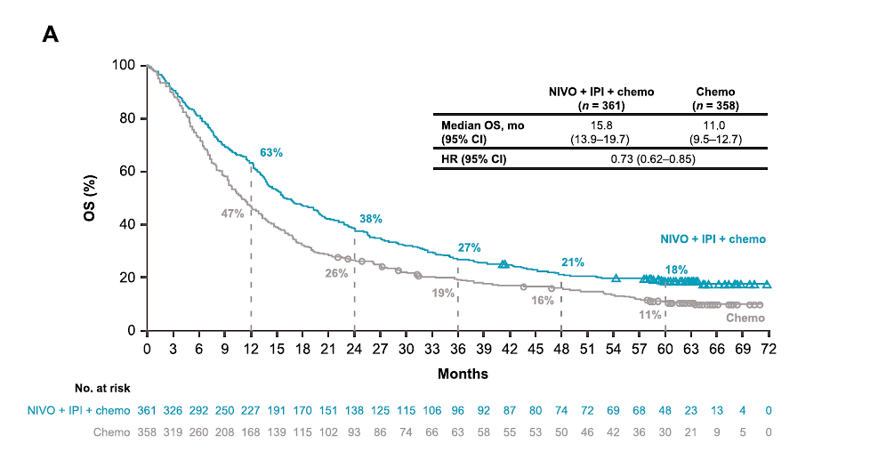
CheckMate 9LA: IIT UPDATED OS
Reck Eur J Cancer 2024

Slide 67
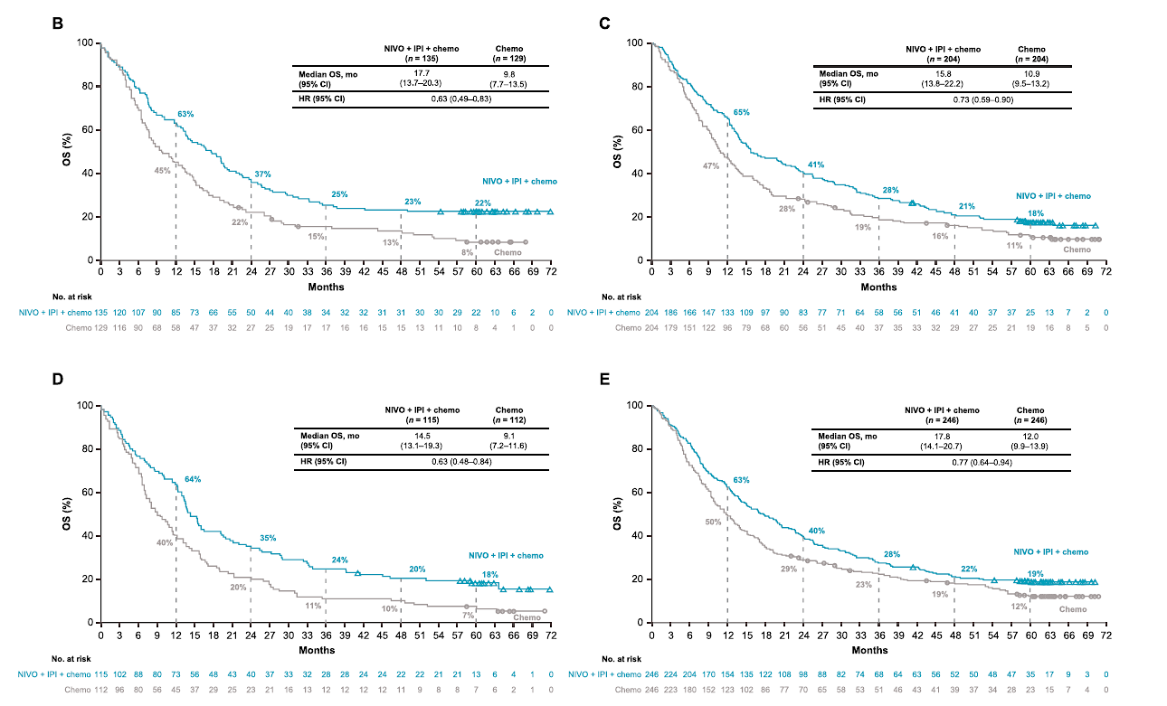
CheckMate 9LA: UPDATED OS
PD-L1 < 1%
PD-L1 > 1%
Squamous
Non-Squamous
Reck Eur J Cancer 2024

Slide 68
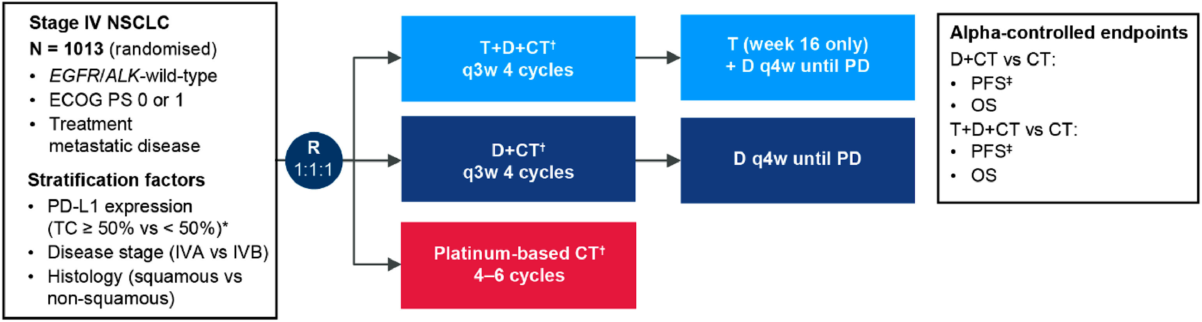
POSEIDON STUDY DESIGN
Garon Clin Lung Cancer 2024

Slide 69
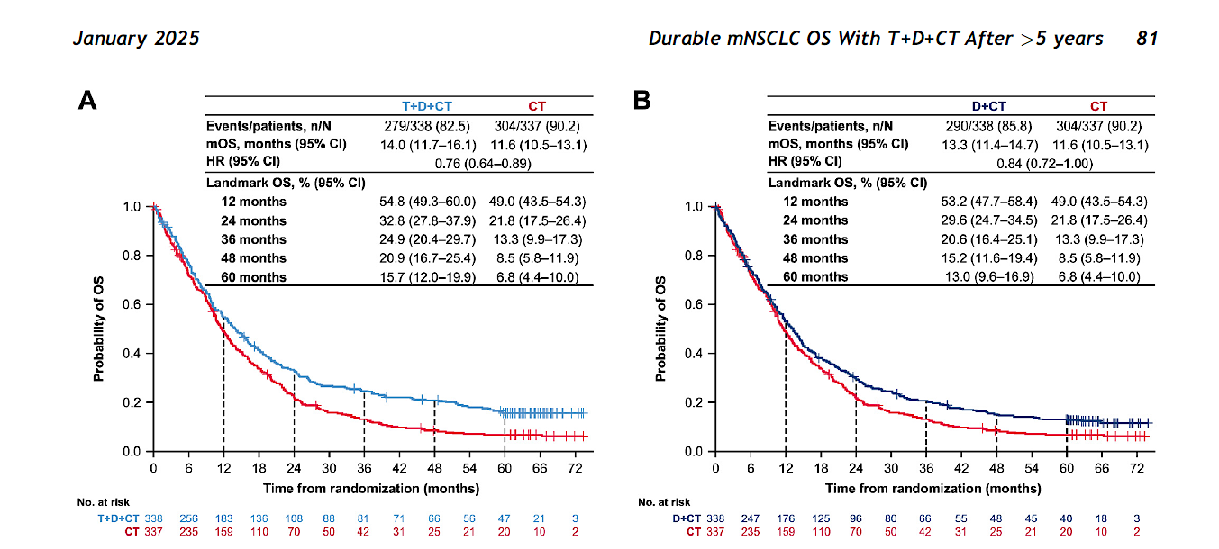
POSEIDON: UPDATED OS
Peters J Thorac Oncol 2025

Slide 70
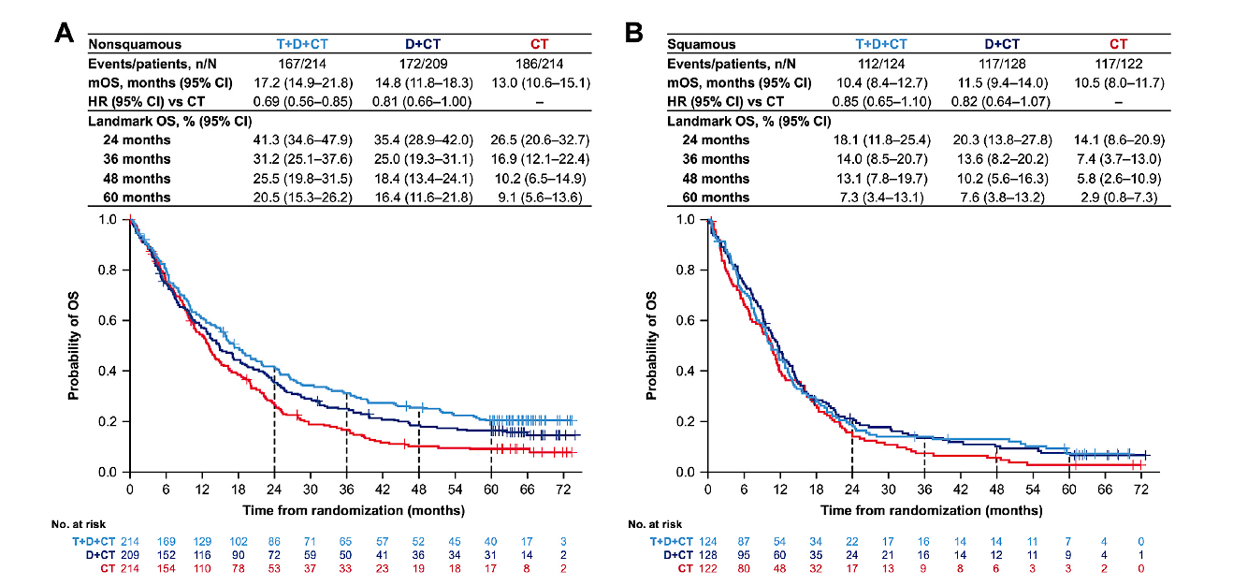
POSEIDON: UPDATED OS
Peters J Thorac Oncol 2025

Slide 71
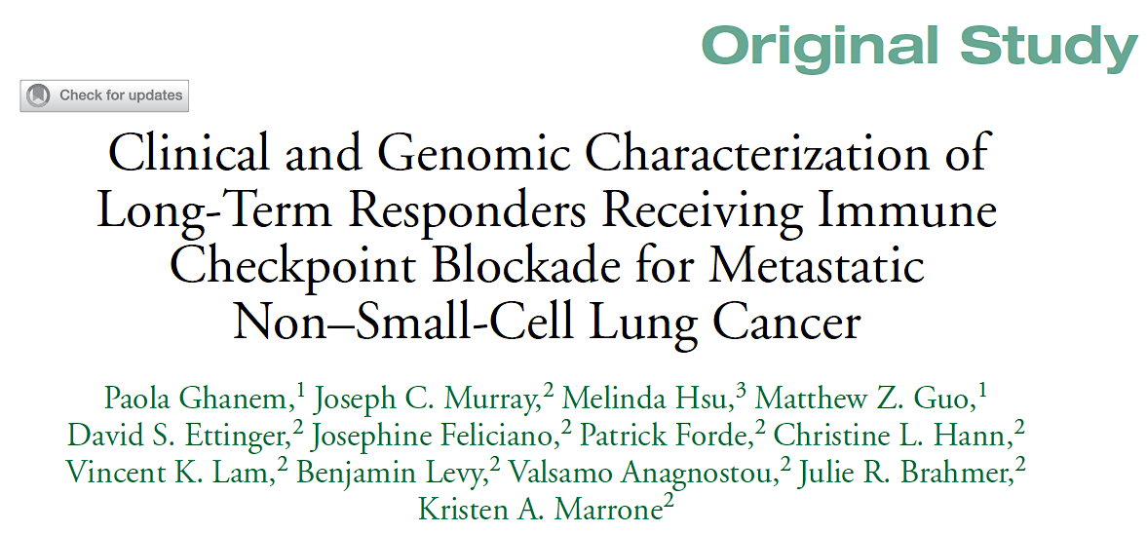
Clin Lung Cancer 2024;25(2):109-18.

Slide 72
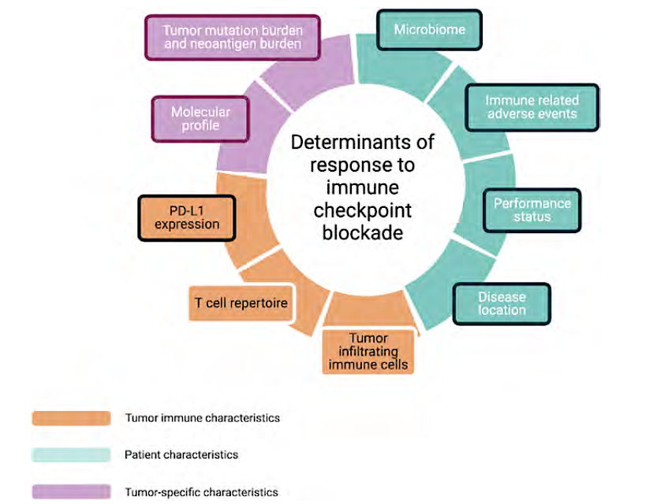
Determinants of Clinical Benefit with Immune Checkpoint Blockade
Ghanem P et al. Clin Lung Cancer 2024;25(2):109-18.

Slide 73
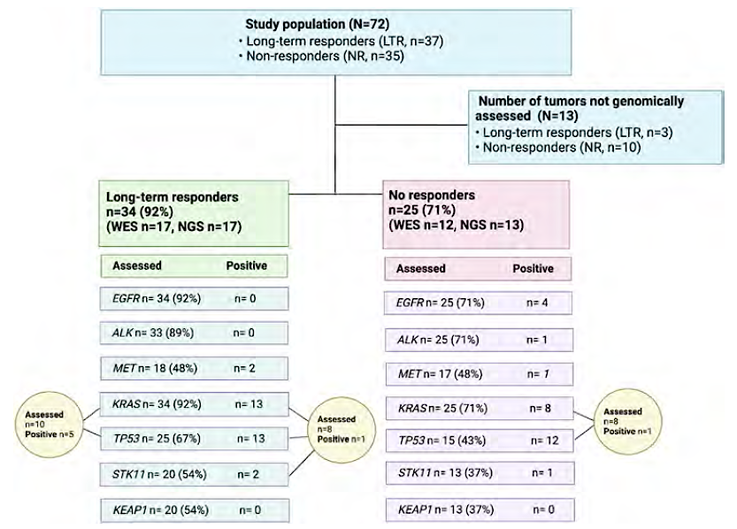
Genomic Features by Cohort
Ghanem P et al. Clin Lung Cancer 2024;25(2):109-18.

Slide 74
QUESTIONS?

Slide 75
Year in Review:
Nontargeted Approaches for Lung Cancer
INTRODUCTION: The Boards
MODULE 1: Immune Checkpoint Inhibition for Localized Non-Small Cell Lung
Cancer (NSCLC)
MODULE 2: Immunotherapy for Metastatic NSCLC
MODULE 3: Antibody-Drug Conjugates
MODULE 4: Novel Bispecific Antibodies
MODULE 5: Journal Club with Dr Levy

Slide 76
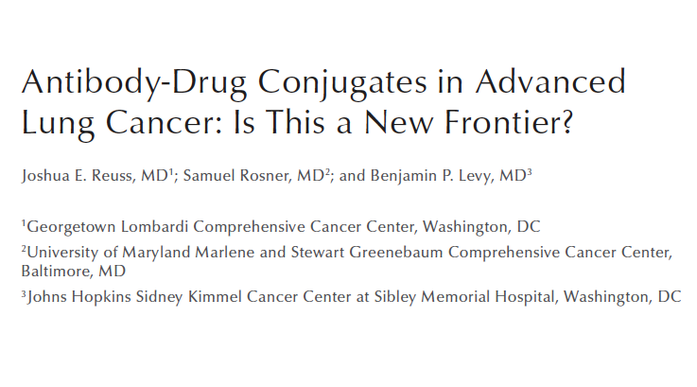
Clin Adv Hematol Oncol 2024;22(5):217-26.

Slide 77
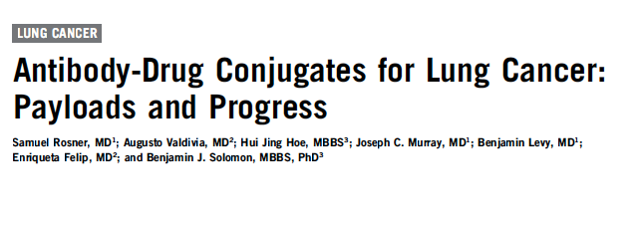
Am Soc Clin Oncol Educ Book 2023;43:e389968.

Slide 78
Datopotamab Deruxtecan vs Docetaxel in NSCLC
TROPION-Lung01: Study Design
Key Eligibility Criteria
NSCLC (stage IIIB, IIIC, or IV)
ECOG PS of 0 or 1
No prior docetaxel
Without actionable genomic alterations
  1 or 2 prior lines, including platinum CT and anti–PD-(L)1 mAb therapy
With actionable genomic alterations
  Positive for EGFR, ALK, NTRK, BRAF, ROS1, MET exon 14 skipping, or RET
  1 or 2 prior approved targeted therapies + platinum-based CT, and ≤ 1 anti–PD-(L)1 mAb
Dato-DXd
6 mg/kg IV Q3W
(n = 299)
Primary Endpoints
PFS assessed by BICR, per RECIST v1.1 OS
Key Secondary Endpoints
ORR by BICR DOR by BICR Safety
N = 590
R 1:1
Docetaxel
75 mg/m² Q3W
(n = 305)
Stratification by
Histology (actionable genomic alteration)
Anti-PD-(L)1 mAb included in most recent prior therapy, geography

Slide 79
Datopotamab Deruxtecan vs Docetaxel in NSCLC
TROPION-Lung01: Primary Endpoints
  Dual primary endpoints: PFS endpoint met, but OS endpoint not met
 | Dato-DXd (n = 299) | Docetaxel (n = 305)
No. of events/No. of patients | 213/299 | 218/305
Median PFS, months (95% CI) | 4.4 (4.2-5.6) | 3.7 (2.9-4.2)
HR (95% CI) P value | 0.75 (0.62-0.91) 0.004
100
80
 | Datopotamab deruxtecan | Docetaxel
ORR | 26.4% | 12.8%
mDOR | 7.1 mos | 5.6 mos
mPFS | 4.4 mos | 3.7 mos
mOS | 12.9 mos | 11.8 mos
60
PFS (%)
40
Dato-DXd
20
Docetaxel
0
0
2
4
6
8
10
12
14
16
18
Months
 | Dato-DXd (n = 299) | Docetaxel (n = 305)
No. of events/No. of patients | 215/299 | 218/305
Median OS, months (95% CI) | 12.9 (11.0-13.9) | 11.8 (10.0-12.8)
HR (95% CI) P value | 0.94 (0.78-1.14) 0.530
100
80
60
OS (%)
40
Dato-DXd
20
Docetaxel
0
0
2
4
6
8
10
12
14
16
18
20
22
24
26
28
30
32
34
Months
Ahn MJ J Clin Oncol. 2025

Slide 80
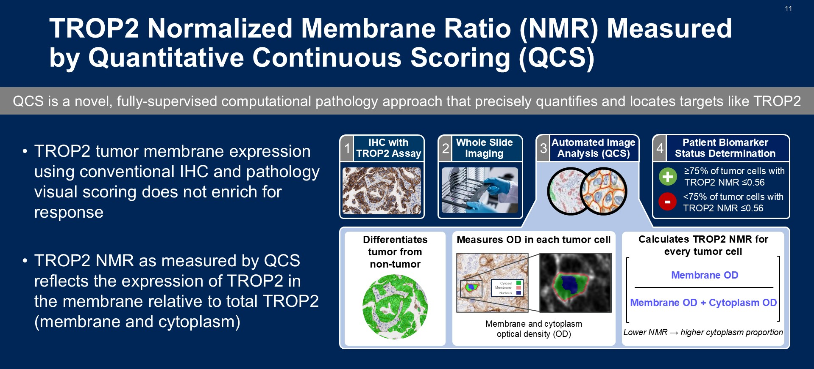
Slide 11
Levy ASCO 2025; Abstract 8501

Slide 81
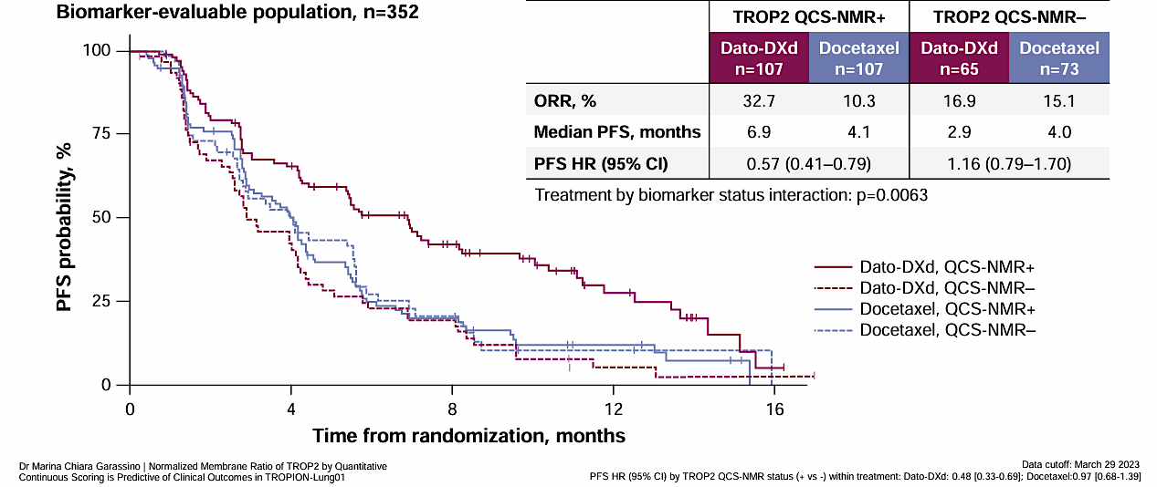
Overall BEP: Efficacy by TROP2 QCS-NMR Status
TROP2 QCS-NMR positivity is predictive for longer PFS with Dato-DXd in the biomarker-evaluable population
Garassino et al WCLC 2024

Slide 82
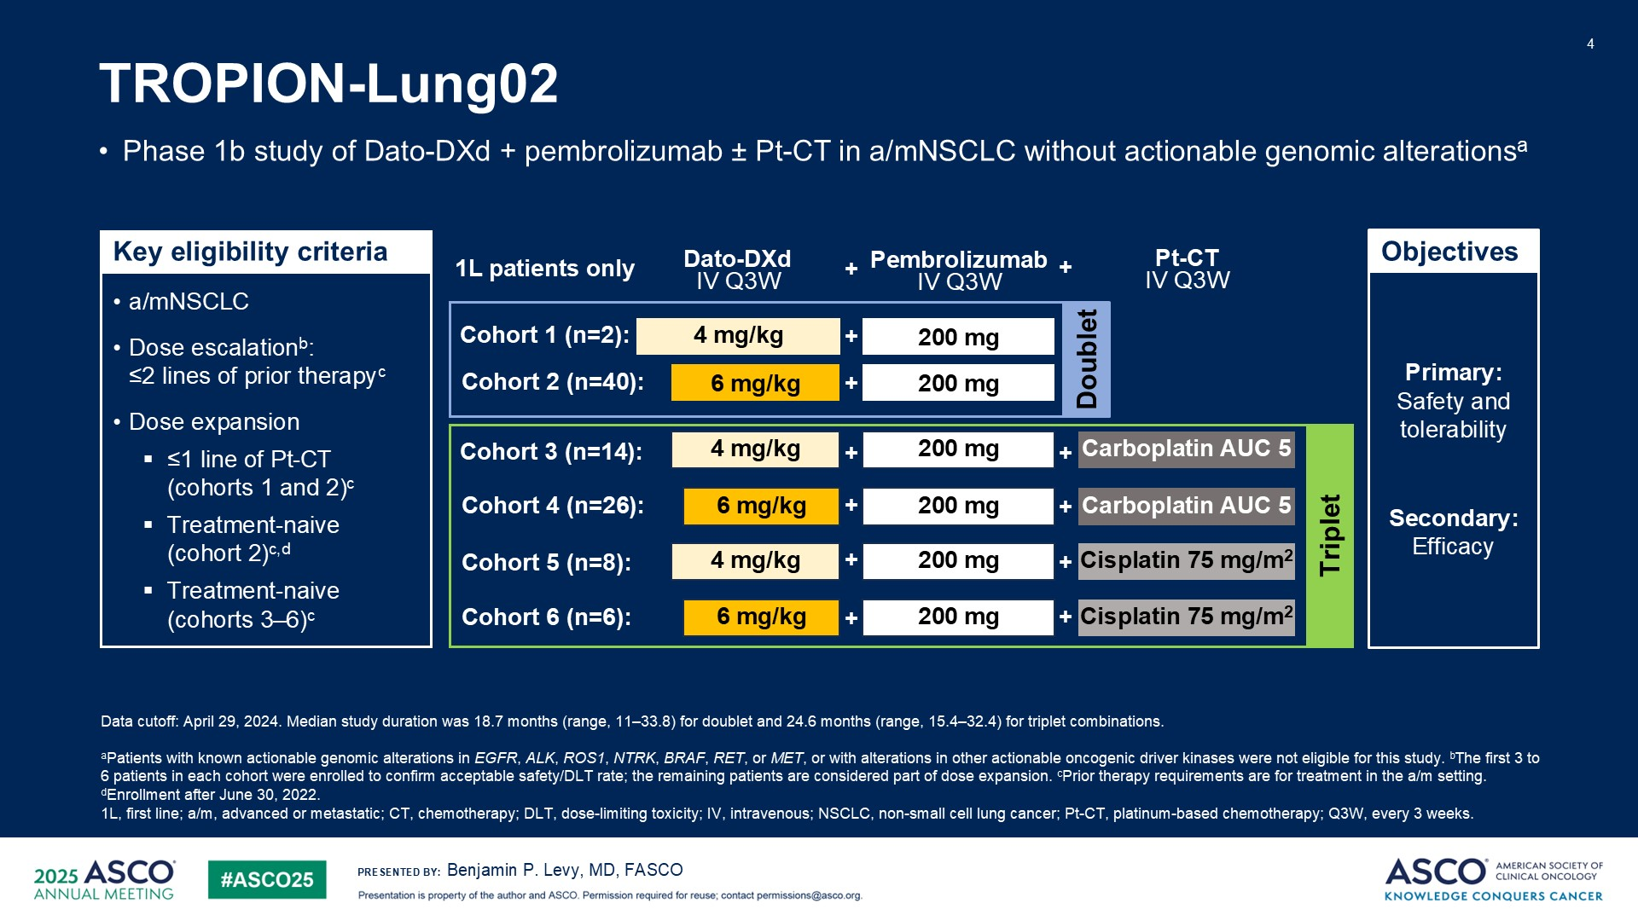
TROPION-Lung02

Slide 83
TROPION-Lung02: Efficacy, 1L Doublet
 | Doublet (n=42)
Confirmed ORR*, n (%) | 23 (54.8)
95% CI | 38.7–70.2
Median DOR, months | 20.1
95% CI | 9.7–NE
DCR, n (%) | 37 (88.1)
95% CI | 74.4–96.0
Median TTR, months | 1.4
Range | 1.2–7.0
Median PFS, months | 11.2
95% CI | 8.2–21.3
Median OS, months | NE
95% CI | 19.2–NE
Progression-Free Survival
100
Median PFS (95% CI)
Doublet: 11.2 months (8.2–21.3)
80
60
Progression-free survival (%)
40
20
Censored
0
0
2
4
6
8
10
12
14
16
18
20
22
24
26
28
30
32
Time since start of treatment (months)
No. at risk:
Doublet 42 36 32 28 25 22 12 10 8 6 5 4 4 4 2 0
Data cutoff: April 29, 2024. *1 CR, 22 PR. Pooled data including patients who received Dato-DXd 4mg/kg (5%) and Dato-DXd 6 mg/kg (doublet: 95%)
1L, first line; BOR, best overall response; CI, confidence interval; CR, complete response; DCR, disease control rate; DOR, duration of response; NE, not evaluable; ORR, objective response rate; PR, partial response;
TTR, time to response.
Benjamin P. Levy, MD, FASCO

Slide 84
TROPION-Lung02: Efficacy, 1L Triplet
Progression-Free Survival
 | Triplet (n=54)
Confirmed ORR*, n (%) | 30 (55.6)
95% CI | 41.4–69.1
Median DOR, months | 13.7
95% CI | 5.7–NE
DCR, n (%) | 48 (88.9)
95% CI | 77.4–95.8
Median TTR, months | 1.4
Range | 1.2–9.6
Median PFS, months | 6.8
95% CI | 5.5–11.1
Median OS, months | 17.4
95% CI | 9.1–NE
100
Median PFS (95% CI)
Triplet: 6.8 months (5.5–11.1)
80
60
Progression-free survival (%)
40
20
Censored
0
0
2
4
6
8
10
12
14
16
18
20
22
24
26
28
30
32
Time since start of treatment (months)
No. at risk:
Triplet 54 48 38 28 23 20 18 17 14 9 7 6 5 4 2 1 0
Data cutoff: April 29, 2024. *2 CR, 28 PR. Pooled data including patients who received Dato-DXd 4mg/kg (41%) and Dato-DXd 6 mg/kg (59%)
1L, first line; BOR, best overall response; CI, confidence interval; CR, complete response; DCR, disease control rate; DOR, duration of response; NE, not evaluable; ORR, objective response rate; PR, partial response;
TTR, time to response.
Benjamin P. Levy, MD, FASCO

Slide 85
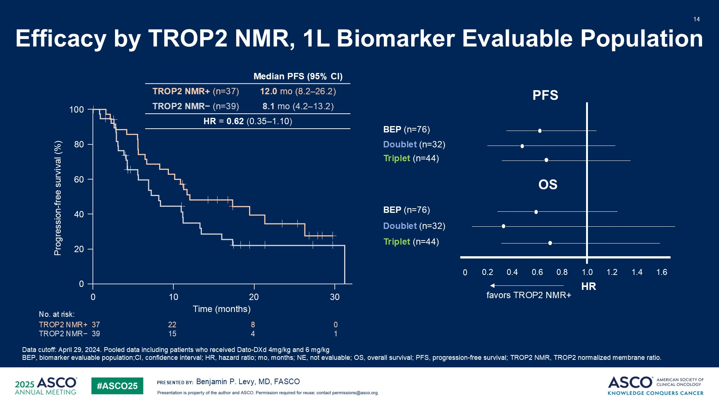
Efficacy by TROP2 NMR, 1L Biomarker Evaluable Population
TROPION-Lung02

Slide 86
QUESTIONS?

Slide 87
Year in Review:
Nontargeted Approaches for Lung Cancer
INTRODUCTION: The Boards
MODULE 1: Immune Checkpoint Inhibition for Localized Non-Small Cell Lung
Cancer (NSCLC)
MODULE 2: Immunotherapy for Metastatic NSCLC
MODULE 3: Antibody-Drug Conjugates
MODULE 4: Novel Bispecific Antibodies
MODULE 5: Journal Club with Dr Levy

Slide 88
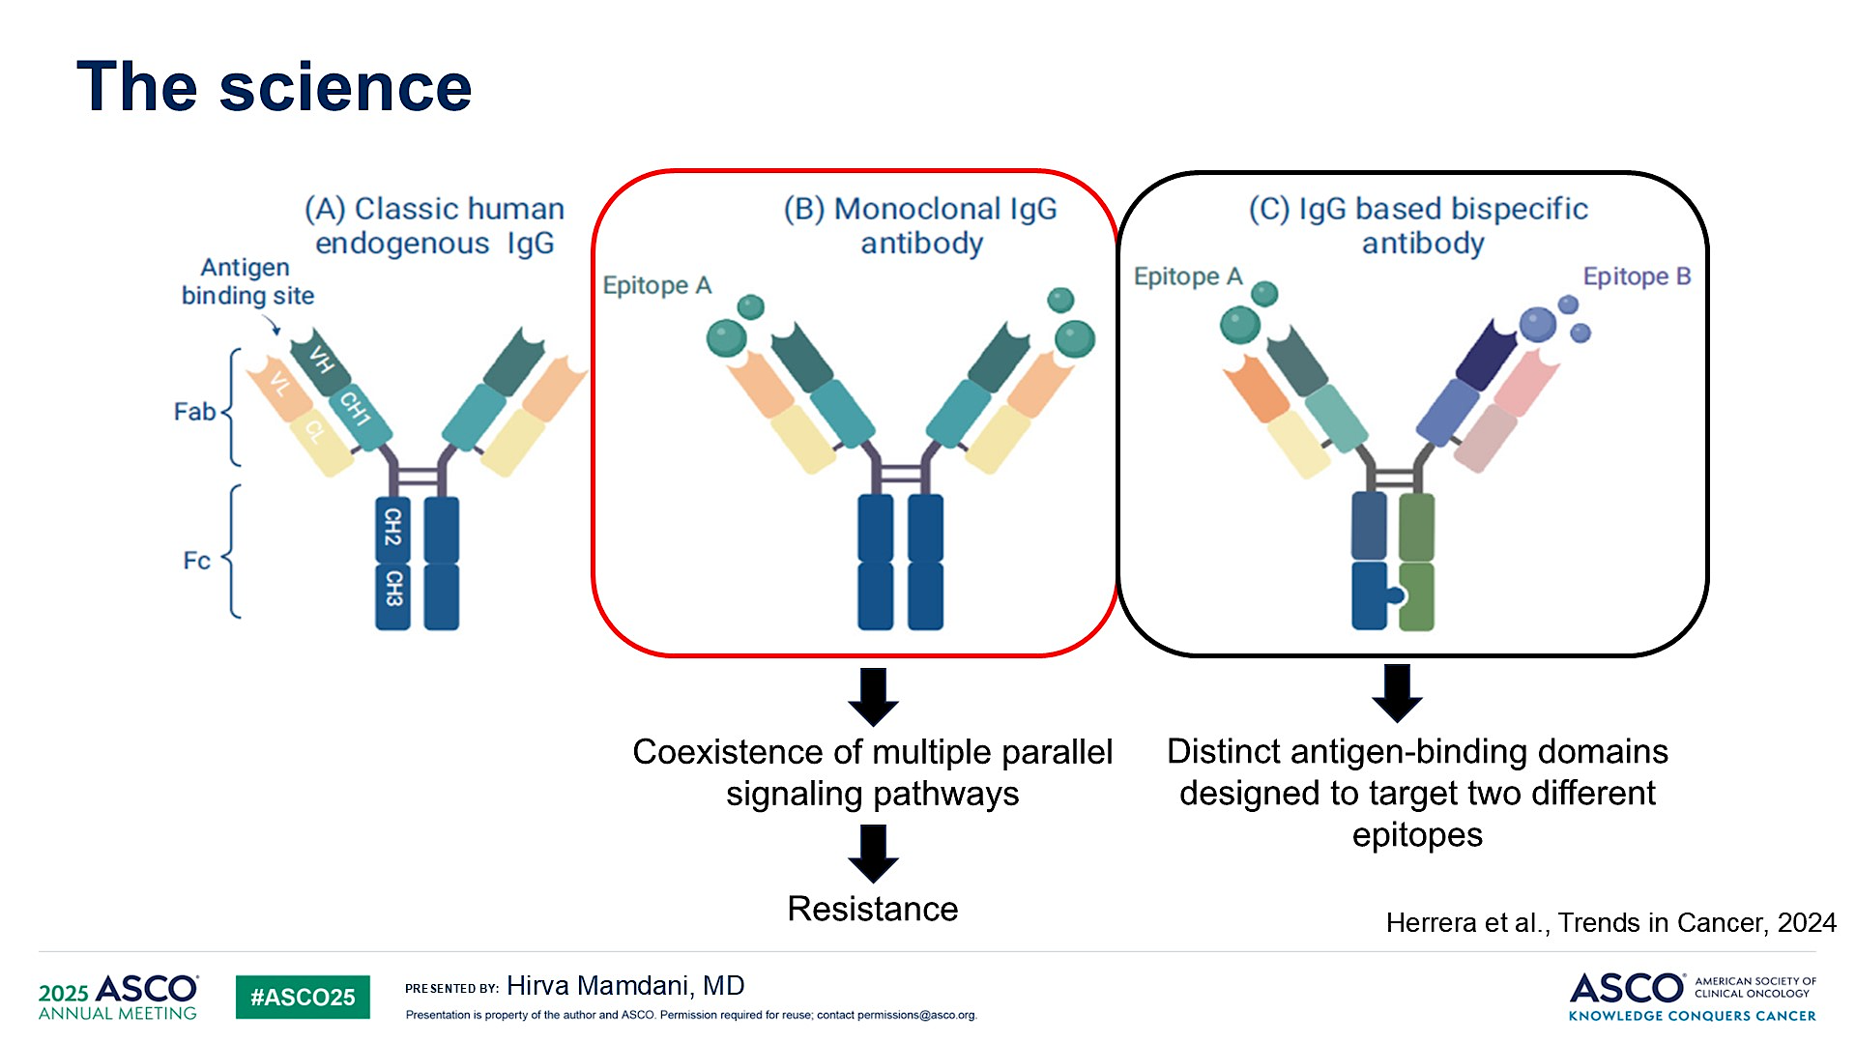
The science
Mamdani ASCO 2025; Clinical Science Symposium

Slide 89
HARMONi-2 STUDY
Ivonescimab vs Pembrolizumab for PD-L1 positive NSCLC
(NCT05499390)
Xiong Lancet 2025

Slide 90
Xiong Lancet 2025

Slide 91
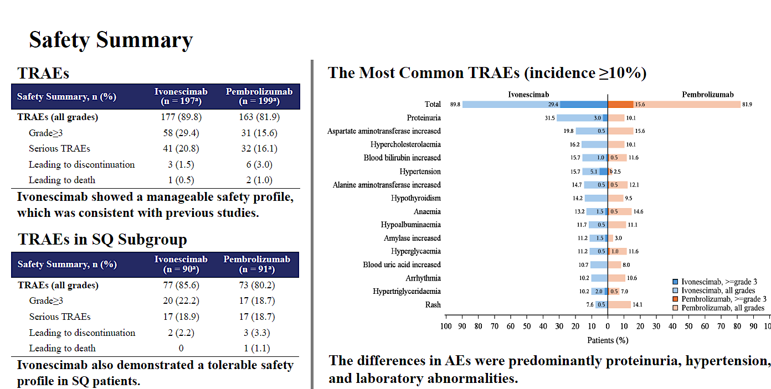
HARMONi-2
Zhou WCLC 2024; Abstract PL02.04

Slide 92
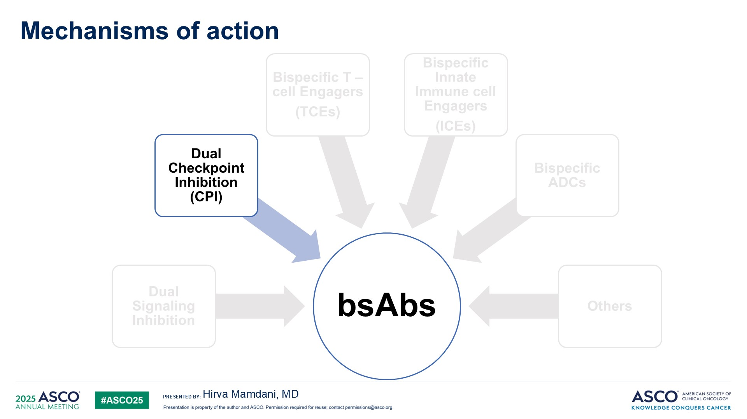
Mechanisms of action
Mamdani ASCO 2025; Clinical Science Symposium

Slide 93

Dual CPI
Mamdani ASCO 2025; Clinical Science Symposium

Slide 94

Volrustomig
Mamdani ASCO 2025; Clinical Science Symposium

Slide 95

Volrustomig: Toxicity
Mamdani ASCO 2025; Clinical Science Symposium

Slide 96

Volrustomig: Ongoing Trials
Mamdani ASCO 2025; Clinical Science Symposium

Slide 97

Rilvegostomig
Mamdani ASCO 2025; Clinical Science Symposium

Slide 98

Rilvegostomig: Toxicity
Mamdani ASCO 2025; Clinical Science Symposium

Slide 99

Rilvegostomig: Ongoing Trials
Mamdani ASCO 2025; Clinical Science Symposium

Slide 100


Phase II Study of Acasunlimab with or without Pembrolizumab for Previously Treated Metastatic NSCLC
Aerts J et al. ASCO 2024;Abstract 2533.

Slide 101


Acasunlimab with or without Pembrolizumab: Efficacy by PD-L1 Status
ORR = objective response rate; DCR = disease control rate; DOR = duration of response; PFS = progression-free survival; OS = overall survival; TPS = tumor proportion score
Aerts J et al. ASCO 2024;Abstract 2533.

Slide 102

Acasunlimab with or without Pembrolizumab: Safety
Blood alkaline phosphatase increased
TRAEs = treatment-related adverse events
Aerts J et al. ASCO 2024;Abstract 2533.

Slide 103



Ongoing Phase III ABBIL1TY NSCLC-06 Trial Schema
Paz-Ares L et al. ELCC 2025;Abstract 128TiP.

Slide 104
QUESTIONS?

Slide 105
Year in Review:
Nontargeted Approaches for Lung Cancer
INTRODUCTION: The Boards
MODULE 1: Immune Checkpoint Inhibition for Localized Non-Small Cell Lung
Cancer (NSCLC)
MODULE 2: Immunotherapy for Metastatic NSCLC
MODULE 3: Antibody-Drug Conjugates
MODULE 4: Novel Bispecific Antibodies
MODULE 5: Journal Club with Dr Levy

Slide 106

2023;29(10):2559-69.

Slide 107

BR36 Trial Schema
Target enrollment of 50 patients reached
First stage
Anagnostou V et al. Nat Med 2023;29(10):2559-69.

Slide 108

BR36 Consort Flow Diagram
Anagnostou V et al. Nat Med 2023;29(10):2559-69.

Slide 109

Overview of Plasma Variants Detected by Next-Generation Sequencing
ctDNA = circulating tumor DNA
Anagnostou V et al. Nat Med 2023;29(10):2559-69.

Slide 110

Representative ctDNA Kinetics Patterns
Anagnostou V et al. Nat Med 2023;29(10):2559-69.

Slide 111

Radiographic Response Assessment, Molecular Response and OS
Anagnostou V et al. Nat Med 2023;29(10):2559-69.

Slide 112

PFS and OS for Patients with ctDNA Molecular Responses
Anagnostou V et al. Nat Med 2023;29(10):2559-69.

Slide 113

Depth of ctDNA Response in Association with RECIST Radiographic Response
maxMAF = maximal mutant allele fraction; CR = complete response; PR = partial response; SD = stable disease; PD = progressive disease
Anagnostou V et al. Nat Med 2023;29(10):2559-69.

Slide 114

2024;30(2):389-403.

Slide 115

Overview of Study Methodology
NGS = next-generation sequencing
Murray JC et al. Clin Cancer Res 2024;30(2):389-403.

Slide 116

Course of Disease for Each Patient
Murray JC et al. Clin Cancer Res 2024;30(2):389-403.

Slide 117

Landscape of Variants Detected in Plasma
Murray JC et al. Clin Cancer Res 2024;30(2):389-403.

Slide 118

Longitudinal Cell-Free Tumor Load Dynamics and Molecular Response Classifications
BOR = best overall radiographic response
Murray JC et al. Clin Cancer Res 2024;30(2):389-403.

Slide 119

Association Between ctDNA Maximum Mutant Allele Fraction (max MAF) Dynamics and Molecular Response
Murray JC et al. Clin Cancer Res 2024;30(2):389-403.

Slide 120

Association Between ctDNA Molecular Responses and Radiographic Response Assessments
DCB = durable clinical benefit; NDB = nondurable clinical benefit; mPD = molecular progressive disease; mR = molecular response; mR f/b REC/EM = mR followed by recrudescence/emergence
Murray JC et al. Clin Cancer Res 2024;30(2):389-403.

Slide 121

Association Between Cell-Free Tumor Load (cfTL) Clearance and PFS and OS
Murray JC et al. Clin Cancer Res 2024;30(2):389-403.

Slide 122

Survival Outcomes in the Cohort of Patients with Radiographically Stable Disease
Murray JC et al. Clin Cancer Res 2024;30(2):389-403.

Slide 123

cfTL Clearance and Tumor Responses
SLD = sum of tumor longest diameter; TT = time to
Murray JC et al. Clin Cancer Res 2024;30(2):389-403.

Slide 124


T-Cell Receptor Clonal Dynamics and Clinical Benefit and Development of Immune-Related Adverse Events (irAEs)
Murray JC et al. Clin Cancer Res 2024;30(2):389-403.

Slide 125

T-Cell Receptor (TCR) Clonal Dynamics and Immunotherapy-Related Pneumonitis
Murray JC et al. Clin Cancer Res 2024;30(2):389-403.

Slide 126

Examples of TCR Cluster Dynamics in Patients with Immune-Related Adverse Events
Murray JC et al. Clin Cancer Res 2024;30(2):389-403.

Slide 127
Optimizing the Selection of First-Line Therapy for Patients with Multiple Myeloma
A CME/MOC-Accredited Live Webinar
Tuesday,​ July 1, 2025
5:00 PM – 6:00 PM ET
Faculty
Xavier Leleu, MD, PhD
Peter Voorhees, MD
Moderator
Neil Love, MD

Slide 128
Thank you for joining us!
Please take a moment to complete the survey currently up on Zoom. Your feedback is very important to us. The survey will remain open for 5 minutes after the meeting ends.
Information on how to obtain CME, ABIM MOC and ABS credit is provided in the Zoom chat room. Attendees will also receive an email in
1 to 3 business days with these instructions.

