Slide 1
Year in Review:
Management of Gynecologic Cancers
A CME/MOC-Accredited Live Webinar
Tuesday,​ June 17, 2025
5:00 PM – 6:00 PM ET
Faculty
Susana Banerjee, MBBS, MA, PhD
Ursula Matulonis, MD
Moderator
Neil Love, MD

Slide 2



Faculty
Susana Banerjee, MBBS, MA, PhD
Consultant Medical Oncologist
The Royal Marsden NHS Foundation Trust
Professor in Women’s Cancers
The Institute of Cancer Research, London
President
Royal Society of Medicine, Oncology Section
London, United Kingdom
MODERATOR
Neil Love, MD
Research To Practice
Miami, Florida
Ursula Matulonis, MD
Chief, Division of Gynecologic Oncology
Brock-Wilson Family Chair
Dana-Farber Cancer Institute
Professor of Medicine
Harvard Medical School
Boston, Massachusetts

Slide 3
Commercial Support
This activity is supported by educational grants from AstraZeneca Pharmaceuticals LP, Daiichi Sankyo Inc, GSK, and Natera Inc.

Slide 4
Dr Love — Disclosures
Dr Love is president and CEO of Research To Practice. Research To Practice receives funds in the form of educational grants to develop CME activities from the following companies: Aadi Bioscience, AbbVie Inc, ADC Therapeutics, Alexion Pharmaceuticals, Amgen Inc, Array BioPharma Inc, a subsidiary of Pfizer Inc, Arvinas, Astellas, AstraZeneca Pharmaceuticals LP, Aveo Pharmaceuticals, Bayer HealthCare Pharmaceuticals, BeiGene Ltd, Black Diamond Therapeutics Inc, Blueprint Medicines, Boehringer Ingelheim Pharmaceuticals Inc, Bristol Myers Squibb, Clovis Oncology, Coherus BioSciences, CTI BioPharma, a Sobi Company, Daiichi Sankyo Inc, Eisai Inc, Elevation Oncology Inc, Exact Sciences Corporation, Exelixis Inc, Genentech, a member of the Roche Group, Genmab US Inc, Geron Corporation, Gilead Sciences Inc, GSK, Hologic Inc, ImmunoGen Inc, Incyte Corporation, Ipsen Biopharmaceuticals Inc, Jazz Pharmaceuticals Inc, Johnson & Johnson, Karyopharm Therapeutics, Kite, A Gilead Company, Kura Oncology, Legend Biotech, Lilly, MEI Pharma Inc, Merck, Mersana Therapeutics Inc, Mirati Therapeutics Inc, Mural Oncology Inc, Natera Inc, Novartis, Novartis Pharmaceuticals Corporation on behalf of Advanced Accelerator Applications, Novocure Inc, Nuvalent, Pfizer Inc, Pharmacyclics LLC, an AbbVie Company, Puma Biotechnology Inc, Regeneron Pharmaceuticals Inc, Rigel Pharmaceuticals Inc, R-Pharm US, Sanofi, Seagen Inc, Servier Pharmaceuticals LLC, SpringWorks Therapeutics Inc, Stemline Therapeutics Inc, Syndax Pharmaceuticals, Taiho Oncology Inc, Takeda Pharmaceuticals USA Inc, TerSera Therapeutics LLC, and Tesaro, A GSK Company.

Slide 5
Research To Practice CME Planning Committee Members,
Staff and Reviewers
Planners, scientific staff and independent reviewers for Research To Practice have no relevant conflicts of interest to disclose.

Slide 6
Prof Banerjee — Disclosures
Consulting Agreements | AbbVie Inc, AstraZeneca Pharmaceuticals LP, BeiGene Ltd, BioNTech SE, Eisai Inc, Epsilogen, Genmab US Inc, Gilead Sciences Inc, GSK, Greywolf Therapeutics, ImmunoGen Inc, Incyte Corporation, ITM Oncologics GmbH, Lilly, Mersana Therapeutics Inc, MSD, Myriad Genetic Laboratories Inc, OncXerna Therapeutics Inc, pharmaand GmbH, Seagen Inc, TORL BioTherapeutics, Verastem Inc, Zymeworks Inc
Contracted Research | AbbVie Inc, AstraZeneca Pharmaceuticals LP, GSK, ImmunoGen Inc, Verastem Inc
Nonrelevant Financial Relationships | Perci Health

Slide 7
Dr Matulonis — Disclosures
Advisory Committees | AbbVie Inc, AstraZeneca Pharmaceuticals LP, Daiichi Sankyo Inc, Day One Biopharmaceuticals, GSK, NextCure, Novartis, Tango Therapeutics
Consulting Agreements | Whitehawk Therapeutics
Data and Safety Monitoring Boards/Committees | Daiichi Sankyo Inc, MacroGenics Inc, Mural Oncology Inc, Symphogen A/S

Slide 8
This educational activity contains discussion of
non-FDA-approved uses of agents and regimens. Please refer to official prescribing information for each product for approved indications.

Slide 9
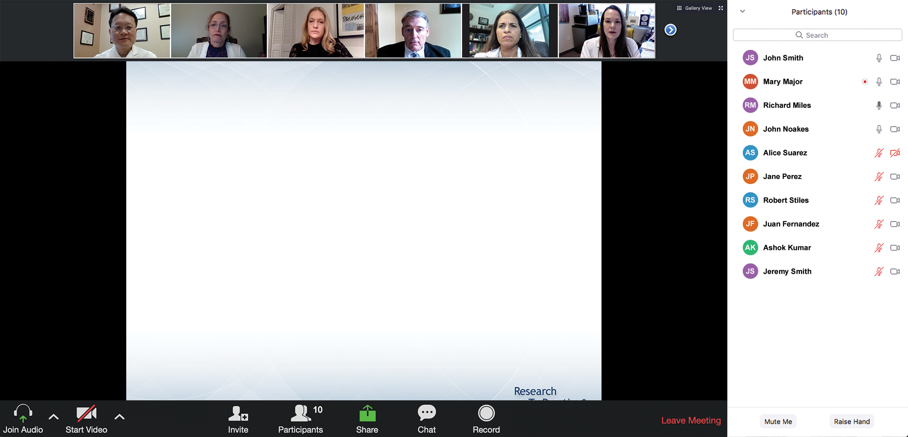

We Encourage Clinicians in Practice to Submit Questions
Feel free to submit questions now before the program begins and throughout the program.

Slide 10
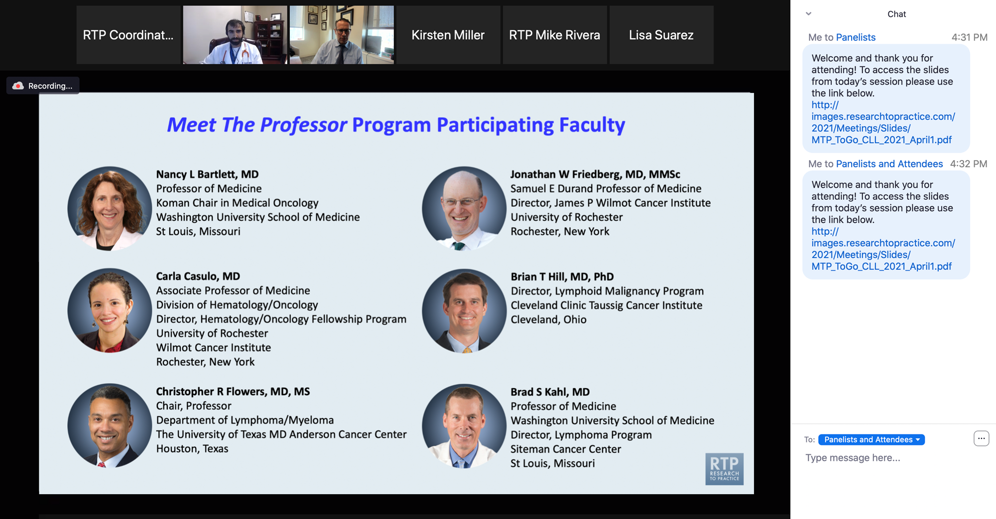
Familiarizing Yourself with the Zoom Interface
Expand chat submission box
Drag the white line above the submission box up to create
more space for your message.

Slide 11
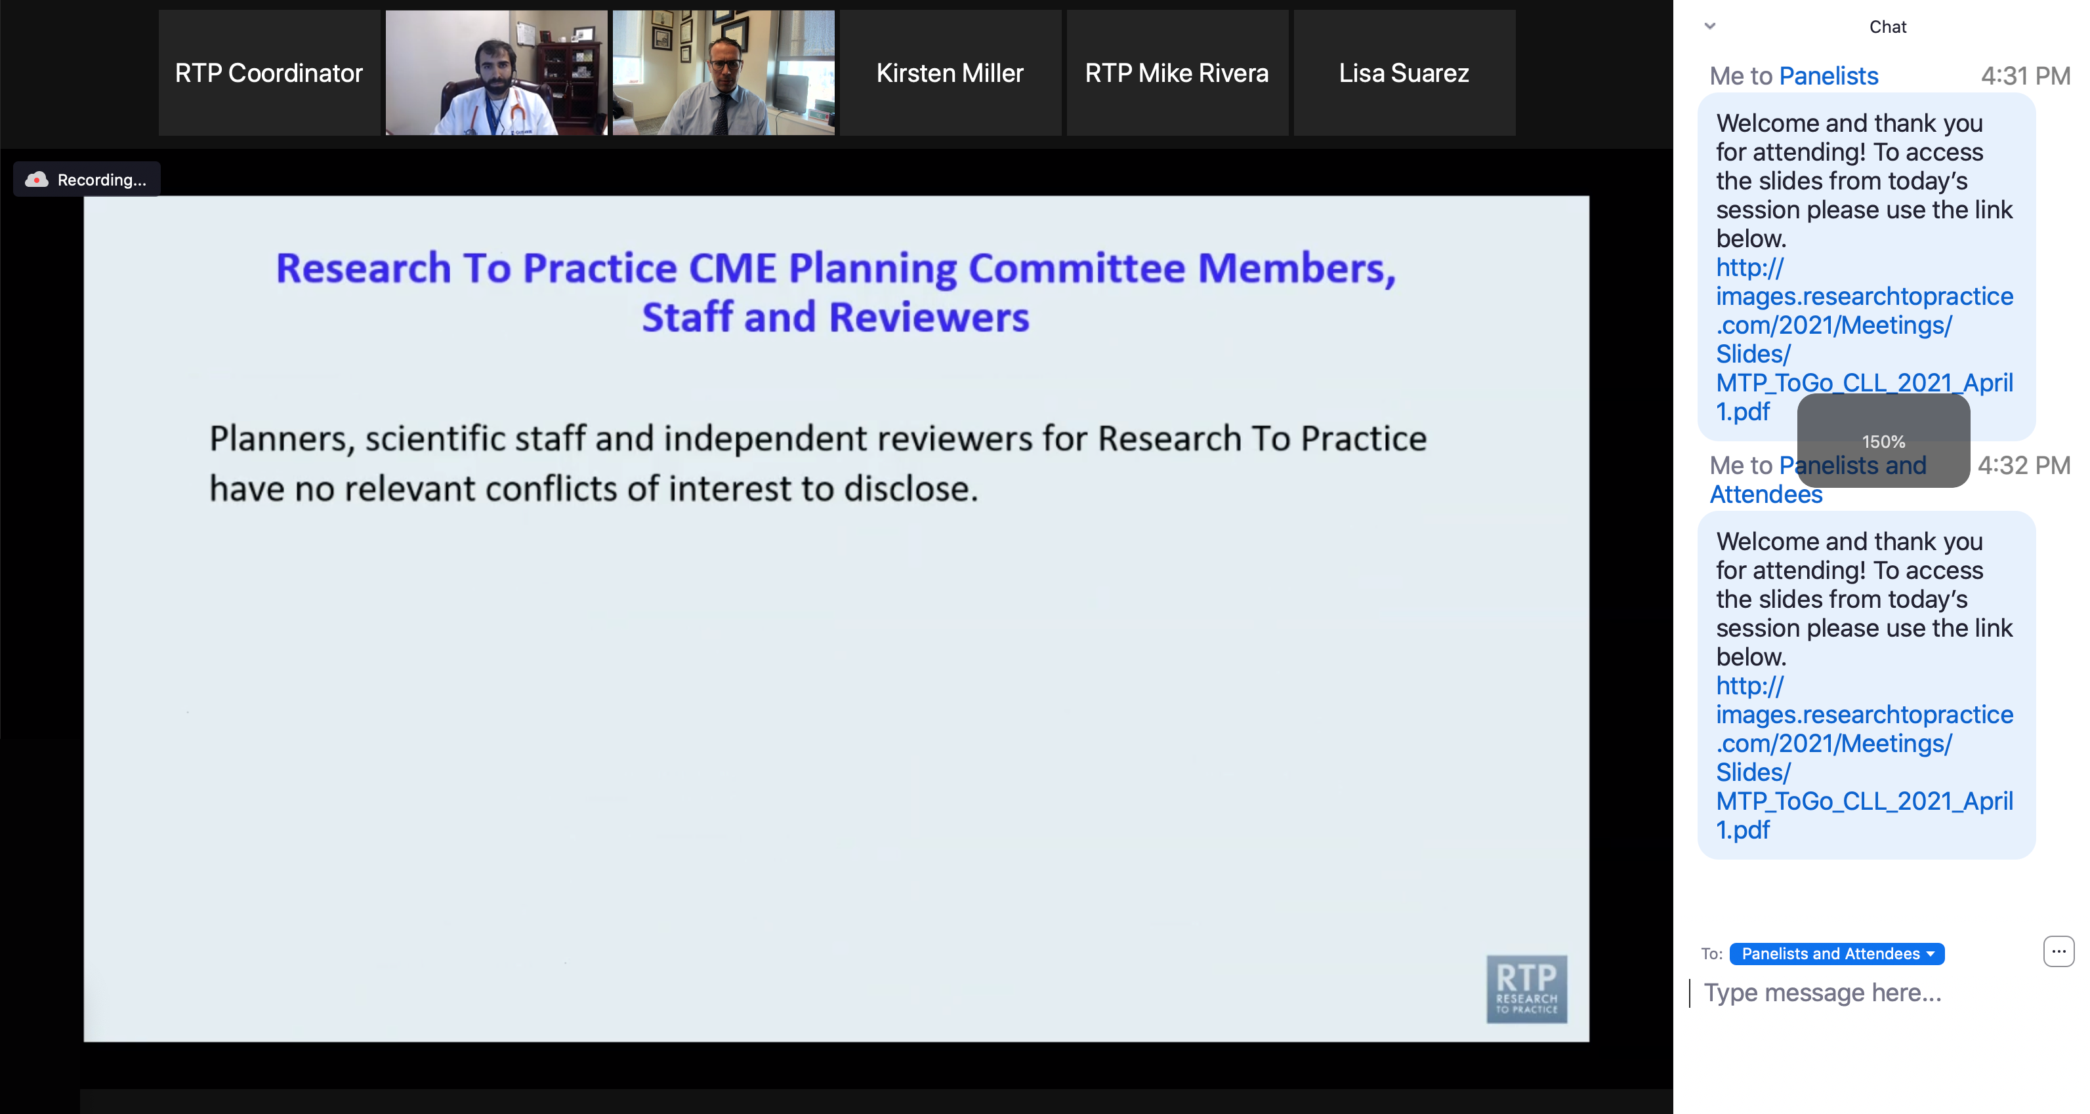
Familiarizing Yourself with the Zoom Interface
Increase chat font size
Press Command (for Mac) or Control (for PC) and the + symbol.
You may do this as many times as you need for readability.

Slide 12
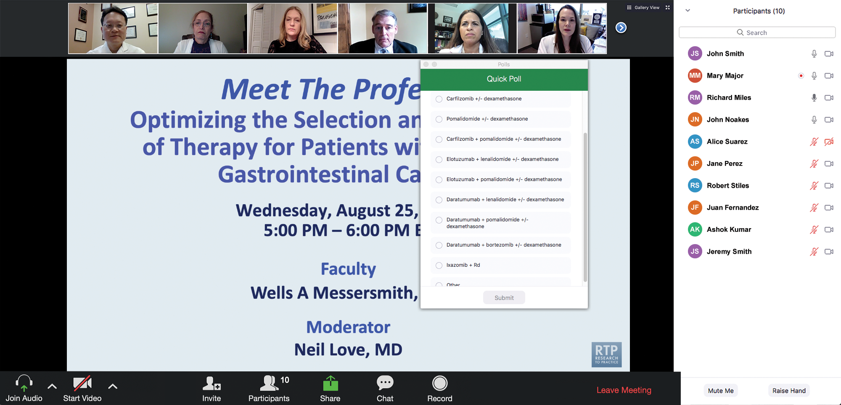
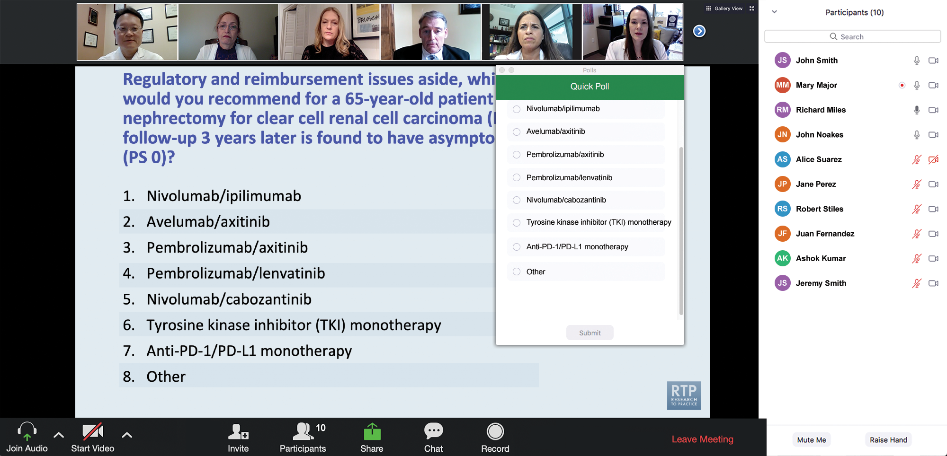
Clinicians in the Audience, Please Complete the Pre- and Postmeeting Surveys
Quick Survey
Quick Poll

Slide 13


Slide 14
Year in Review: Clinical Investigator Perspectives on the
Most Relevant New Datasets and Advances in Oncology
Nontargeted Approaches for Lung Cancer
A CME/MOC-Accredited Live Webinar
​Tuesday,​ June 24, 2025
5:00 PM – 6:00 PM ET
Faculty
Benjamin Levy, MD
Moderator
Neil Love, MD

Slide 15
Optimizing the Selection of First-Line Therapy for Patients with Multiple Myeloma
A CME/MOC-Accredited Live Webinar
Tuesday,​ July 1, 2025
5:00 PM – 6:00 PM ET
Faculty
Xavier Leleu, MD, PhD
Peter Voorhees, MD
Moderator
Neil Love, MD

Slide 16
Cancer Q&A: Addressing Common Questions Posed by
Patients with Relapsed/Refractory Multiple Myeloma
A Webinar Series for Clinicians and Patients,
Developed in Partnership with CancerCare®
Tuesday, July 8, 2025
6:00 PM – 7:00 PM ET
Wednesday, July 23, 2025
5:00 PM – 6:00 PM ET
Faculty
Natalie S Callander, MD
Sagar Lonial, MD, FACP
Moderator
Neil Love, MD

Slide 17
Practical Perspectives: Experts Review Actual Cases of Patients with Small Cell Lung Cancer
A CME/MOC-Accredited Live Webinar
Wednesday, July 16, 2025
5:00 PM – 6:00 PM ET
Faculty
Stephen V Liu, MD
Charles Rudin, MD, PhD
Moderator
Neil Love, MD

Slide 18
Year in Review:
Management of Gynecologic Cancers
INTRODUCTION: Tale of Two Cities — ASCO 2025
MODULE 1: Ovarian Cancer
MODULE 2: HER2-Positive Gynecologic Cancers
MODULE 3: Endometrial Cancer
MODULE 4: Cervical Cancer

Slide 19
Thank you for joining us!
Please take a moment to complete the survey currently up on Zoom.
Your feedback is very important to us.
Information on how to obtain CME, ABIM MOC and ABS credit will be provided in the Zoom chat room. Attendees will also receive an email in
1 to 3 business days with these instructions.

Slide 20
Year in Review:
Management of Gynecologic Cancers
A CME/MOC-Accredited Live Webinar
Tuesday,​ June 17, 2025
5:00 PM – 6:00 PM ET
Faculty
Susana Banerjee, MBBS, MA, PhD
Ursula Matulonis, MD
Moderator
Neil Love, MD

Slide 21
Faculty
Susana Banerjee, MBBS, MA, PhD
Consultant Medical Oncologist
The Royal Marsden NHS Foundation Trust
Professor in Women’s Cancers
The Institute of Cancer Research, London
President
Royal Society of Medicine, Oncology Section
London, United Kingdom
MODERATOR
Neil Love, MD
Research To Practice
Miami, Florida
Ursula Matulonis, MD
Chief, Division of Gynecologic Oncology
Brock-Wilson Family Chair
Dana-Farber Cancer Institute
Professor of Medicine
Harvard Medical School
Boston, Massachusetts

Slide 22
We Encourage Clinicians in Practice to Submit Questions
Feel free to submit questions now before the program begins and throughout the program.

Slide 23
Clinicians in the Audience, Please Complete the Pre- and Postmeeting Surveys
Quick Survey
Quick Poll

Slide 25
Year in Review: Clinical Investigator Perspectives on the
Most Relevant New Datasets and Advances in Oncology
Nontargeted Approaches for Lung Cancer
A CME/MOC-Accredited Live Webinar
​Tuesday,​ June 24, 2025
5:00 PM – 6:00 PM ET
Faculty
Benjamin Levy, MD
Moderator
Neil Love, MD

Slide 26
Optimizing the Selection of First-Line Therapy for Patients with Multiple Myeloma
A CME/MOC-Accredited Live Webinar
Tuesday,​ July 1, 2025
5:00 PM – 6:00 PM ET
Faculty
Xavier Leleu, MD, PhD
Peter Voorhees, MD
Moderator
Neil Love, MD

Slide 27
Cancer Q&A: Addressing Common Questions Posed by
Patients with Relapsed/Refractory Multiple Myeloma
A Webinar Series for Clinicians and Patients,
Developed in Partnership with CancerCare®
Tuesday, July 8, 2025
6:00 PM – 7:00 PM ET
Wednesday, July 23, 2025
5:00 PM – 6:00 PM ET
Faculty
Natalie S Callander, MD
Sagar Lonial, MD, FACP
Moderator
Neil Love, MD

Slide 28
Practical Perspectives: Experts Review Actual Cases of Patients with Small Cell Lung Cancer
A CME/MOC-Accredited Live Webinar
Wednesday, July 16, 2025
5:00 PM – 6:00 PM ET
Faculty
Stephen V Liu, MD
Charles Rudin, MD, PhD
Moderator
Neil Love, MD

Slide 29
Commercial Support
This activity is supported by educational grants from AstraZeneca Pharmaceuticals LP, Daiichi Sankyo Inc, GSK, and Natera Inc.
Research To Practice CME Planning Committee Members,
Staff and Reviewers
Planners, scientific staff and independent reviewers for Research To Practice have no relevant conflicts of interest to disclose.

Slide 30
Prof Banerjee — Disclosures
Consulting Agreements | AbbVie Inc, AstraZeneca Pharmaceuticals LP, BeiGene Ltd, BioNTech SE, Eisai Inc, Epsilogen, Genmab US Inc, Gilead Sciences Inc, GSK, Greywolf Therapeutics, ImmunoGen Inc, Incyte Corporation, ITM Oncologics GmbH, Lilly, Mersana Therapeutics Inc, MSD, Myriad Genetic Laboratories Inc, OncXerna Therapeutics Inc, pharmaand GmbH, Seagen Inc, TORL BioTherapeutics, Verastem Inc, Zymeworks Inc
Contracted Research | AbbVie Inc, AstraZeneca Pharmaceuticals LP, GSK, ImmunoGen Inc, Verastem Inc
Nonrelevant Financial Relationships | Perci Health

Slide 31
Dr Matulonis — Disclosures
Advisory Committees | AbbVie Inc, AstraZeneca Pharmaceuticals LP, Daiichi Sankyo Inc, Day One Biopharmaceuticals, GSK, NextCure, Novartis, Tango Therapeutics
Consulting Agreements | Whitehawk Therapeutics
Data and Safety Monitoring Boards/Committees | Daiichi Sankyo Inc, MacroGenics Inc, Mural Oncology Inc, Symphogen A/S

Slide 32
This educational activity contains discussion of
non-FDA-approved uses of agents and regimens. Please refer to official prescribing information for each product for approved indications.

Slide 33



Slide 34
Key Datasets
Ursula Matulonis, MD
Lorusso D et al. Updated progression-free survival and final overall survival with maintenance olaparib plus bevacizumab according to clinical risk in patients with newly diagnosed advanced ovarian cancer in the phase III PAOLA-1/ENGOT-ov25 trial. Int J Gynecol Cancer 2024;34(4):550-8.
Monk BJ et al. Niraparib first-line maintenance therapy in patients with newly diagnosed advanced ovarian cancer: Final overall survival results from the PRIMA/ENGOT-OV26/GOG-3012 trial. Ann Oncol 2024;35(11):981-92.
Graybill WS et al. Predictors of long-term progression-free survival in patients with ovarian cancer treated with niraparib in the PRIMA/ENGOT-OV26/GOG-3012 study. Int J Gynecol Cancer 2024;34(7):1041-50.
Trillsch F et al. Durvalumab (D) + carboplatin/paclitaxel (CP) + bevacizumab (B) followed by D, B + olaparib (O) maintenance (mtx) for newly diagnosed advanced ovarian cancer (AOC) without a tumour BRCA1/BRCA2 mutation (non-tBRCAm): Updated results from DUO-O. ESMO Gynaecological Cancers Congress 2024;Abstract 43O.
Vergote I et al. Chemotherapy with or without pembrolizumab followed by maintenance with olaparib or placebo for first-line treatment of advanced BRCA non-mutated epithelial ovarian cancer: Results from the randomized phase 3 ENGOT-OV43/GOG-3036/KEYLYNK-001 study. ESGO 2025;Abstract 128.
Hardy-Bessard AC et al. FIRST/ENGOT-OV44: A phase 3 clinical trial of dostarlimab (dost) and
niraparib (nira) in first-line (1L) advanced ovarian cancer (aOC). ASCO 2025;Abstract LBA5506.

Slide 35
Key Datasets
Ursula Matulonis, MD (continued)
Van Gorp T et al. Final overall survival analysis among patients with FRα-positive, platinum-resistant ovarian cancer (PROC) treated with mirvetuximab soravtansine (MIRV) vs investigator’s choice chemotherapy (ICC) in the phase 3 MIRASOL (GOG 3045/ENGOT-ov55) study. SGO 2025;Abstract 939696.
Olawaiye AB et al. Relacorilant and nab-paclitaxel in patients with platinum resistant ovarian cancer (ROSELLA): an open-label, randomised, controlled, phase 3 trial. Lancet 2025; June 2 [epub ahead of print].
Phase 3 KEYNOTE-B96 trial met primary endpoint of progression-free survival (PFS) in patients with platinum-resistant recurrent ovarian cancer whose tumors expressed PD-L1 and in all comers [press release]. May 15, 2025. https://www.merck.com/news/merck-announces-phase-3-keynote-b96-trial-met-primary-endpoint-of-progression-free-survival-pfs-in-patients-with-platinum-resistant-recurrent-ovarian-cancer-whose-tumors-expressed-pd-l1-and-in-all-c/.
Moore KN et al. Raludotatug deruxtecan monotherapy among patients with previously treated ovarian cancer: Subgroup analysis of a first-in-human phase I study. Gynecol Oncol 2024;190(Suppl 1):6-7.
Grisham R et al. Avutometinib + defactinib in recurrent low-grade serous ovarian cancer (ENGOT-ov60/GOG-3052/RAMP 201): Dose intensity and subgroup analysis. SGO 2025;Abstract 814605.

Slide 36
Key Datasets
Susana Banerjee, MBBS, MA, PhD
Powell MA et al. Overall survival in patients with endometrial cancer treated with dostarlimab plus carboplatin-paclitaxel in the randomized ENGOT-EN6/GOG-3031/RUBY trial. Ann Oncol 2024;35(8):728-38.
Eskander RN et al. Pembrolizumab plus chemotherapy in advanced or recurrent endometrial cancer: Overall survival and exploratory analyses of the NRG GY018 phase 3 randomized trial. Nat Med 2025 May;31(5):1539-46.
Westin et al. Durvalumab plus carboplatin/paclitaxel followed by durvalumab with or without olaparib as first-line treatment for endometrial cancer: longitudinal changes in circulating tumor DNA. ASCO 2025 Abstract 5512.
Mirza MR et al. Progression-free survival (PFS) in primary advanced or recurrent endometrial cancer (pA/rEC) in the overall and mismatch repair proficient (MMR/MSS) populations and in histological and molecular subgroups: Results from part 2 of the RUBY trial. ESMO Gynaecological Cancers Congress 2024;Abstract 38MO.
Makker V et al. Long-term follow-up of efficacy and safety of selinexor maintenance treatment in patients with TP53wt advanced or recurrent endometrial cancer: A subgroup analysis of the ENGOT-EN5/GOG-3055/SIENDO study. Gynecol Oncol 2024;185:202-11.

Slide 37
Key Datasets
Susana Banerjee, MBBS, MA, PhD (continued)
Recio F et al. Post-surgical ctDNA-based molecular residual disease detection in patients with stage I uterine malignancies. Gynecol Oncol 2024;182:63-9.
Duska LR et al. Pembrolizumab with chemoradiotherapy in patients with high-risk locally advanced cervical cancer: Final analysis results of the phase 3, randomized, double-blind ENGOT-cx11/GOG-3047/KEYNOTE-A18 study. ASCO 2025;Abstract LBA5504.
Mayadev J et al. Ultrasensitive detection and tracking of circulating tumor DNA (ctDNA) and association with relapse and survival in locally advanced cervical cancer (LACC): Phase 3 CALLA trial analyses. ASCO 2025;Abstract 5502.
Lorusso D et al. Pembrolizumab plus chemotherapy for advanced and recurrent cervical cancer: Final analysis according to bevacizumab use in the randomized KEYNOTE-826 study. Ann Oncol 2025;36(1):65-75.
Vergote I et al. Tisotumab vedotin as second- or third-line therapy for recurrent cervical cancer. N Engl J Med 2024;391(1):44-55.
Oaknin A et al. Efficacy of trastuzumab deruxtecan in HER2-expressing solid tumors by enrollment HER2 IHC status: Post hoc analysis of DESTINY-PanTumor02. Adv Ther 2024;41(11):4125-39.

Slide 38
Year in Review:
Management of Gynecologic Cancers
INTRODUCTION: Tale of Two Cities — ASCO 2025
MODULE 1: Ovarian Cancer
MODULE 2: HER2-Positive Gynecologic Cancers
MODULE 3: Endometrial Cancer
MODULE 4: Cervical Cancer

Slide 39
Year in Review:
Management of Gynecologic Cancers
INTRODUCTION: Tale of Two Cities — ASCO 2025
MODULE 1: Ovarian Cancer
MODULE 2: HER2-Positive Gynecologic Cancers
MODULE 3: Endometrial Cancer
MODULE 4: Cervical Cancer

Slide 40
Consensus or Controversy? Clinical Investigators Provide Perspectives on the Current and Future Clinical Care of Patients with EGFR Mutation-Positive Non-Small Cell Lung Cancer
Friday, May 30, 2025
6:30 PM – 8:30 PM CT (7:30 PM – 9:30 PM ET)
Faculty
Nicolas Girard, MD, PhD
Jonathan Goldman, MD
Pasi A Jänne, MD, PhD, FASCO
Suresh S Ramalingam, MD
Joshua K Sabari, MD
Moderator
Helena Yu, MD

Slide 41






Faculty
Nicolas Girard, MD, PhD
Head of Medical Oncology, Institut Curie
Full Professor
UVSQ, Paris-Saclay University
Paris, France
Suresh S Ramalingam, MD
Executive Director, Winship Cancer Institute
Roberto C Goizueta Chair for Cancer Research
Emory University School of Medicine
Atlanta, Georgia
Jonathan Goldman, MD
Professor of Medicine
UCLA Hematology and Oncology
Director of Clinical Trials in Thoracic Oncology
Associate Director of Drug Development
UCLA Health
Santa Monica, California
Joshua K Sabari, MD
Attending Physician
Thoracic Medical Oncology
Assistant Professor of Medicine
NYU Langone Health
Perlmutter Cancer Center
New York, New York
Pasi A Jänne, MD, PhD, FASCO
Senior Vice President for Translational Medicine
Lowe Center for Thoracic Oncology
Professor of Medicine
Harvard Medical School
David M Livingston, MD, Chair
Director, Robert and Renée Belfer Center for Applied
Cancer Science
Director, Chen-Huang Center for EGFR-Mutant Lung Cancers
Dana-Farber Cancer Institute
Boston, Massachusetts
Moderator
Helena Yu, MD
Medical Oncologist
Associate Attending
Memorial Sloan Kettering Cancer Center
New York, New York

Slide 42
Cases from the Community: Investigators Discuss Available Research Guiding the Care of Patients with Colorectal Cancer
Friday, May 30, 2025
6:30 PM – 8:30 PM CT (7:30 PM – 9:30 PM ET)
Faculty
Andrea Cercek, MD
Arvind Dasari, MD, MS
Pashtoon Kasi, MD, MS
Eric Van Cutsem, MD, PhD
Moderator
J Randolph Hecht, MD

Slide 43





Faculty
Andrea Cercek, MD
Section Head, Colorectal Cancer
Co-Director, Center for Young Onset Colorectal
and Gastrointestinal Cancers
Attending, Gastrointestinal Oncology Service
Department of Medicine
Memorial Sloan Kettering Cancer Center
New York, New York
Eric Van Cutsem, MD, PhD
Professor of Medicine
Digestive Oncology
University Hospitals Leuven
Leuven, Belgium
Arvind Dasari, MD, MS
Professor
Department of Gastrointestinal Medical Oncology
The University of Texas
MD Anderson Cancer Center
Houston, Texas
Moderator
J Randolph Hecht, MD
Professor of Clinical Medicine
Director, UCLA GI Oncology Program
Carol and Saul Rosenzweig Chair in Cancer Therapies Development
UCLA David Geffen School of Medicine
Santa Monica, California
Pashtoon Kasi, MD, MS
Medical Director of GI Oncology
Endowed Rad Family Chair in Gastrointestinal Oncology
Associate Professor
Department of Medical Oncology and Therapeutics Research
City of Hope Orange County
Irvine, California

Slide 44
Cases from the Community: Investigators
Discuss Available Research Guiding the Care of
Patients with Ovarian and Endometrial Cancer
Sunday, June 1, 2025
7:00 PM – 9:00 PM CT (8:00 PM – 10:00 PM ET)
Faculty
Joyce F Liu, MD, MPH
David M O’Malley, MD
Ritu Salani, MD, MBA
Alessandro D Santin, MD
Moderator
Shannon N Westin, MD, MPH, FASCO, FACOG

Slide 45





Faculty
Joyce F Liu, MD, MPH
Associate Chief and Director of Clinical Research
Division of Gynecologic Oncology
Dana-Farber Cancer Institute
Boston, Massachusetts
Alessandro D Santin, MD
Professor
Department of Obstetrics and Gynecology
Co-Chief, Gynecologic Oncology
Yale University School of Medicine
New Haven, Connecticut
David M O’Malley, MD
Director and Professor
Division of Gynecologic Oncology in Obstetrics
and Gynecology
John G Boutselis Chair in Gynecologic Oncology
The Ohio State University and The James Comprehensive Cancer Center
Columbus, Ohio
Moderator
Shannon N Westin, MD, MPH, FASCO, FACOG
Professor
Medical Director, Gynecologic Oncology Center
Director, Early Drug Development
Department of Gynecologic Oncology and Reproductive Medicine
The University of Texas
MD Anderson Cancer Center
Houston, Texas
Ritu Salani, MD, MBA
Director, Division of Gynecologic Oncology
Professor, Department of Obstetrics and Gynecology
David Geffen School of Medicine at UCLA
Los Angeles, California

Slide 46
Randomized Trial of Standard Chemotherapy Alone or Combined with Atezolizumab as Adjuvant Therapy for Patients with Stage III Deficient DNA Mismatch Repair (dMMR) Colon Cancer (Alliance A021502; ATOMIC)
Sinicrope F et al.
ASCO 2025;Abstract LBA1.
Three-year disease-free survival:
Atezolizumab/mFOLFOX6 (n = 355), 86.4%
mFOLFOX6 (n = 357), 76.6%
(HR, 0.50; 95% CI, 0.35-0.72)

Slide 47
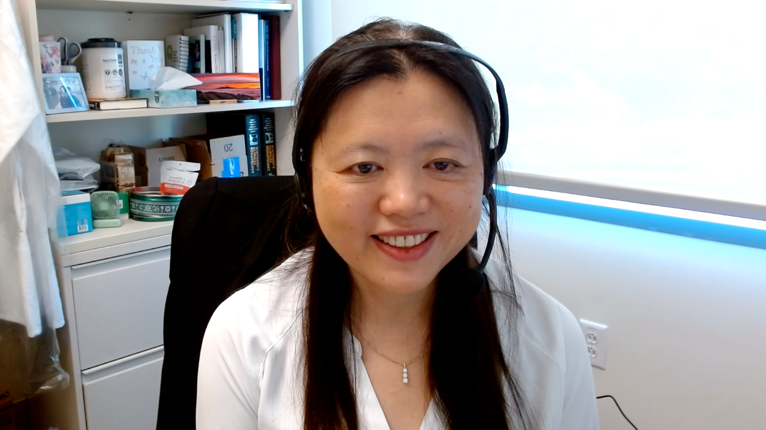
Case Presentation: 61-year-old woman with Stage IIIC dMMR endometrial cancer and Lynch syndrome undergoes debulking surgery and receives carboplatin/docetaxel/pembrolizumab followed by pembrolizumab maintenance
Dr Gigi Chen (Walnut Creek, California)

Slide 48
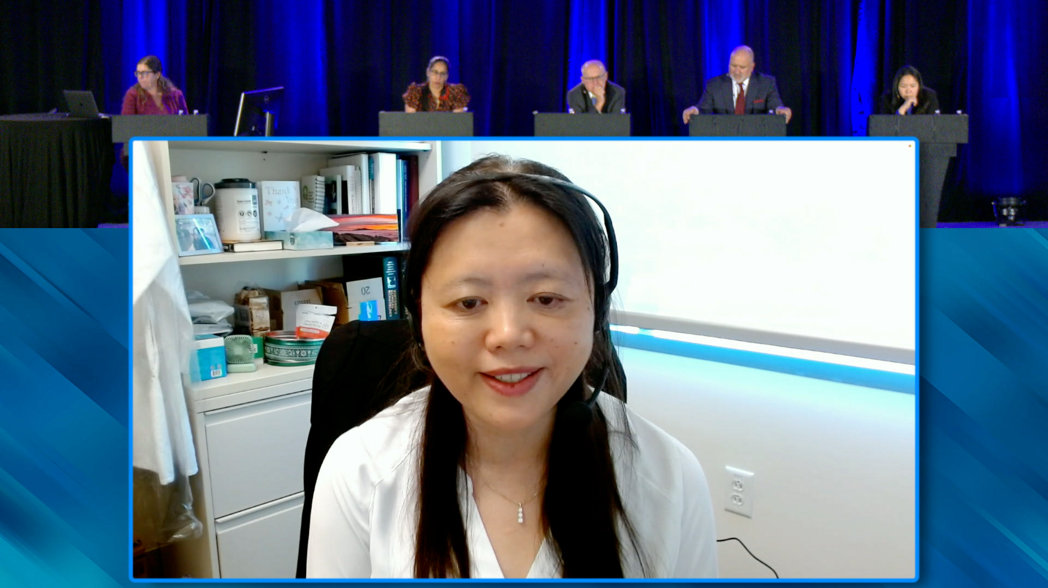

Slide 49
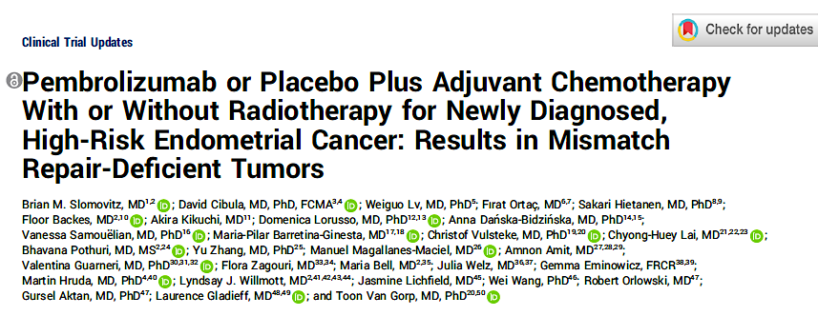
J Clin Oncol 2024;43(3):251-9.

Slide 50
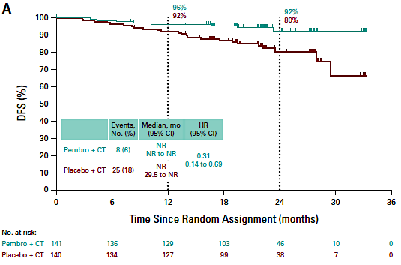
KEYNOTE-B21: Disease-Free Survival with Pembrolizumab and Adjuvant Chemotherapy in Patients with High-Risk Endometrial Cancer and dMMR Tumors
Slomovitz BM et al. J Clin Oncol 2024;43(3):251-9.

Slide 51
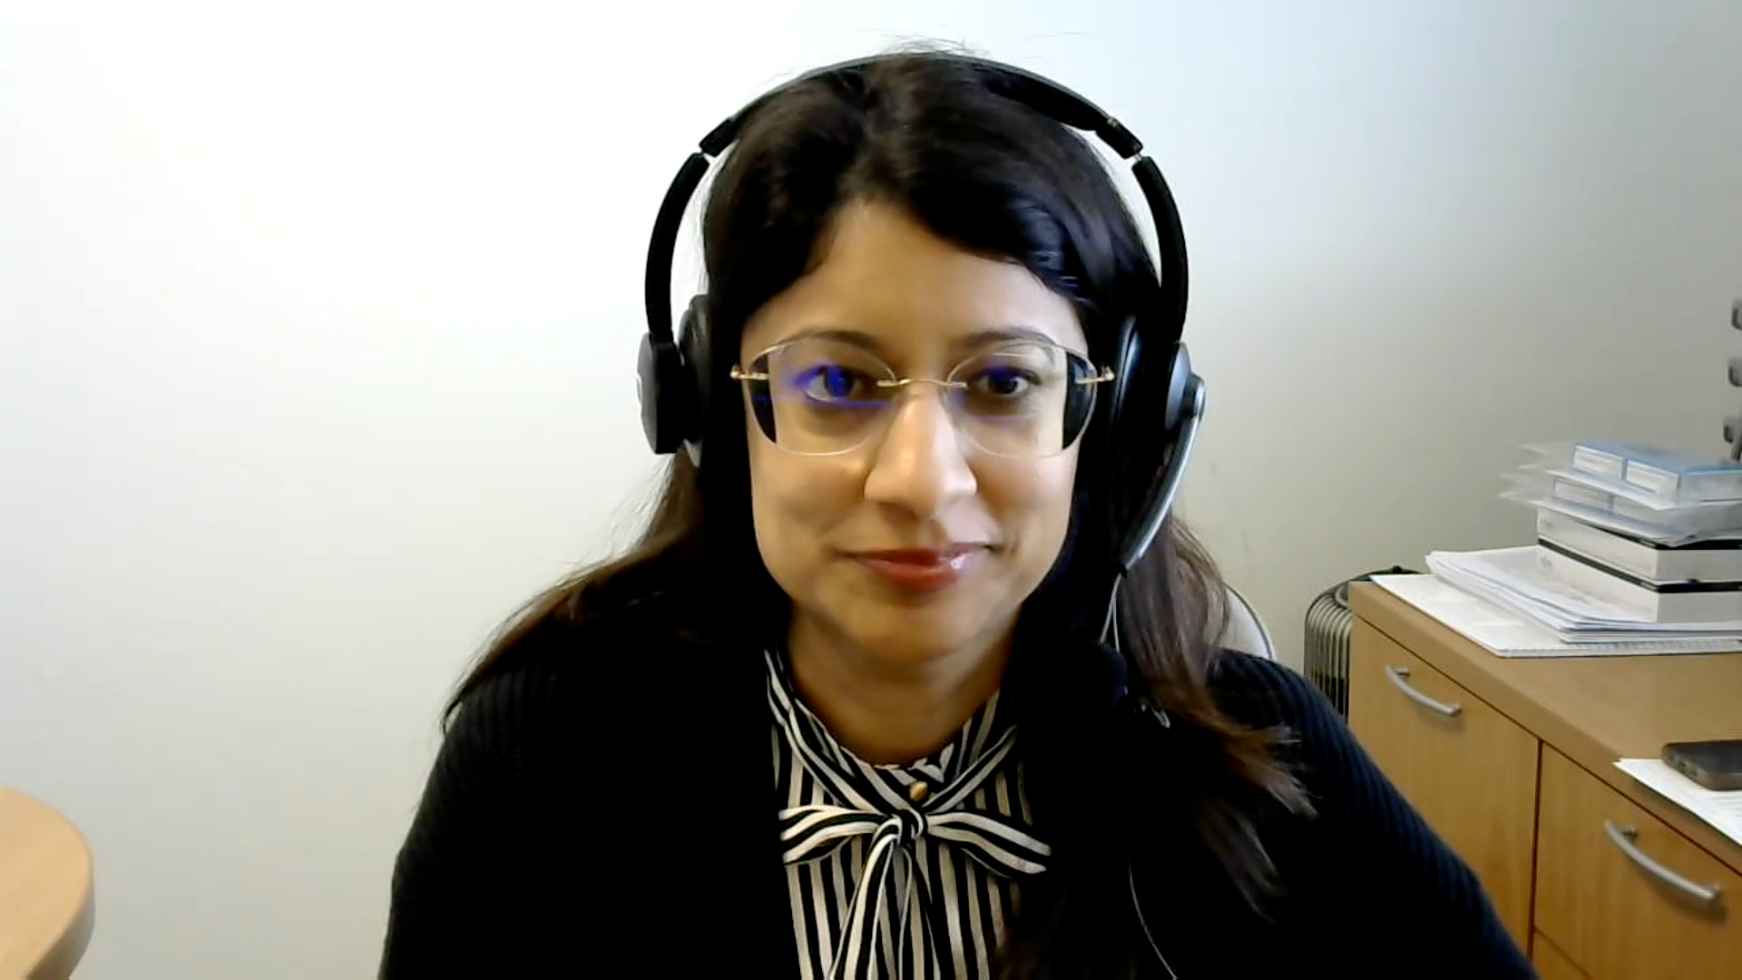
Case Presentation: 68-year-old man with T3N1 MSI-H rectal cancer receives neoadjuvant dostarlimab
Dr Henna Malik (Houston, Texas)

Slide 52
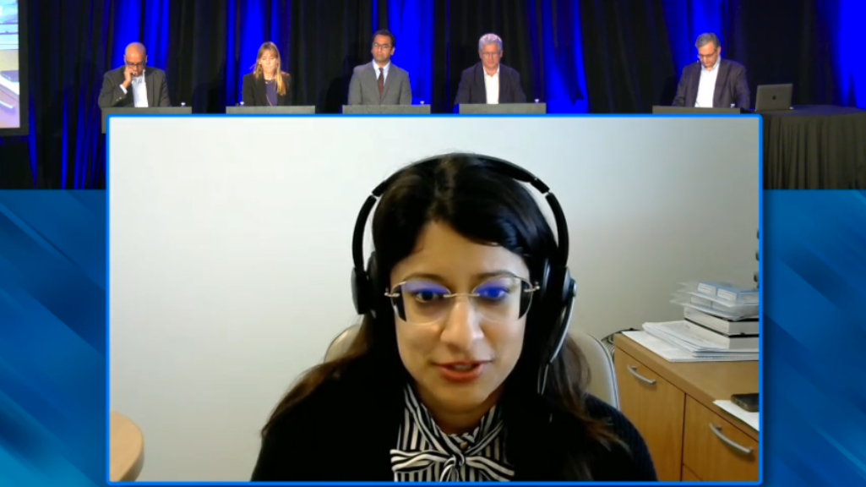

Slide 53
ASCO 2025: Select Abstracts
Montagut C et al. A precision medicine trial leveraging tissue and blood-based tumor genomics to optimize treatment in resected stage III and high-risk stage II colon cancer (CC) patients (pts): The SAGITTARIUS Trial. ASCO 2025;Abstract TPS3647.
Shen JPY et al. Development of a methylation-based, tissue-free test for the detection of molecular residual disease by circulating tumor DNA. ASCO 2025;Abstract 3048.
Oki E et al. Impact of perioperative complications on ctDNA-based MRD detection and prognosis: Insights from the GALAXY study. ASCO 2025;Abstract 3600.*
Osterlund E et al. Biologic correlates of circulating tumor DNA (ctDNA) shedding in the INTERCEPT colorectal cancer (CRC) study. ASCO 2025;Abstract 3591.*
Malla M et al. ctDNA dynamics and targeted therapies associated with genetic mutations in patients with colorectal cancer. ASCO 2025;Abstract 3597.*
Adnan N et al. Signatera ctDNA in stage II CRC: A retrospective comparison with traditional risk factors for survival and prognostic stratification. ASCO 2025;Abstract e15641.
* Includes Stage IV

Slide 54
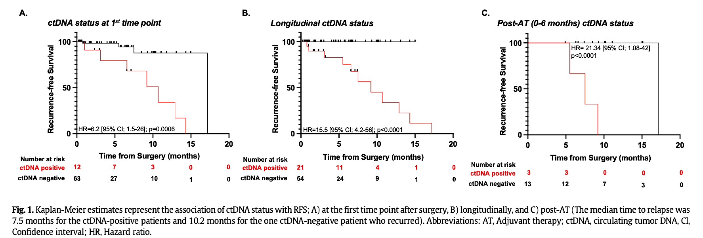
Post-surgical ctDNA detection rates in patients with stage I endometrial malignancies
Recio F et al. Gynecol Oncol 2024:182:63-9.
Courtesy of Susana Banerjee, MBBS, MA, PhD

Slide 55
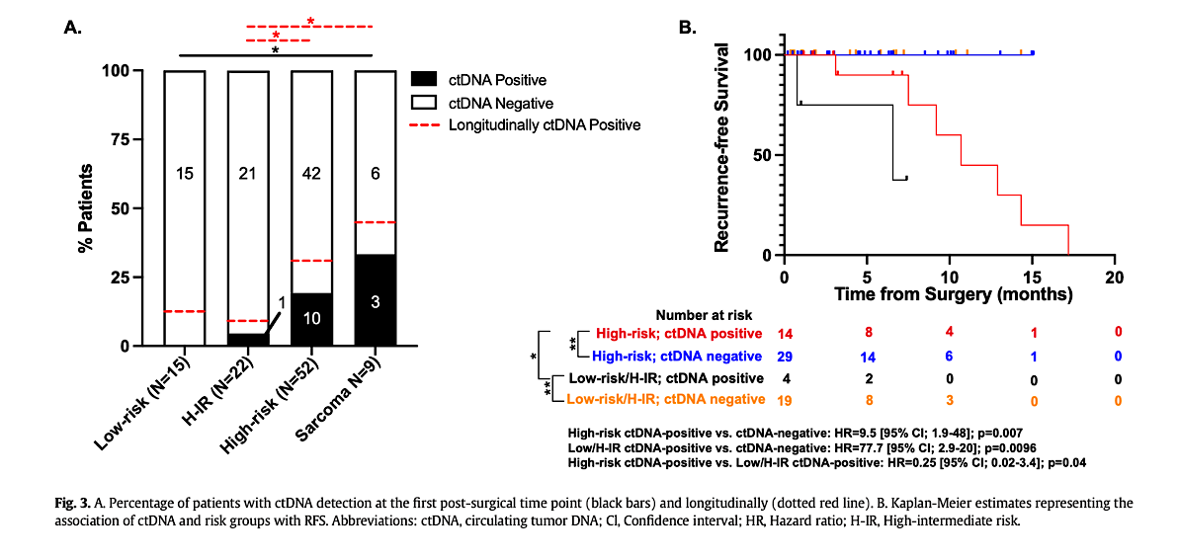
Post-surgical ctDNA detection rates in patients with stage I endometrial malignancies
Results suggest:
patients who were ctDNA-positive at the first time point or at any time point post-surgery had significantly worse RFS (p = 0.0006; p < 0.0001) compared to patients who were either ctDNA-negative at the first time point or remained serially negative.
Increase in ctDNA levels pre- and post-adjuvant therapy identified patients experiencing disease recurrence, while all patients with serially negative ctDNA status remained clinically NED.
Recio F et al. Gynecol Oncol 2024:182:63-9.
Courtesy of Susana Banerjee, MBBS, MA, PhD

Slide 56
Post-surgical ctDNA detection rates in patients with stage I endometrial malignancies
Limitations- retrospective, real world, short follow up
Prospective trials required for incorporation of post-surgical ctDNA status, together with longitudinal ctDNA to direct adjuvant therapy, escalation/ de-escalation, and maintenance therapy in patients with or without detectable ctDNA
Courtesy of Susana Banerjee, MBBS, MA, PhD

Slide 57
Year in Review:
Management of Gynecologic Cancers
INTRODUCTION: Tale of Two Cities — ASCO 2025
MODULE 1: Ovarian Cancer
MODULE 2: HER2-Positive Gynecologic Cancers
MODULE 3: Endometrial Cancer
MODULE 4: Cervical Cancer

Slide 58
Clinical Investigator Perspectives on the Current and Future Role of PARP Inhibition in the Management of Ovarian Cancer
A Meet The Professor Series
August 20, 2020
Don S Dizon, MD
Professor of Medicine, Brown University
Director, Women's Cancers and Hematology-Oncology Outpatient Clinics
Lifespan Cancer Institute
Director, Medical Oncology and the Oncology Sexual Health Program
Rhode Island Hospital
Providence, Rhode Island

Slide 59
Optimizing the Selection and Sequencing of Therapy for Patients with
Chronic Lymphocytic Leukemia
A Meet The Professor Series
August 21, 2020
Brad S Kahl, MD
Professor of Medicine
Washington University School of Medicine
Director, Lymphoma Program
Siteman Cancer Center
St Louis, Missouri

Slide 60

PRIMA: Niraparib as upfront maintenance for advanced high grade ovarian cancer
Patients
Newly diagnosed, stage III or IV
CR or PR to most recent platinum therapy
High grade ovarian cancer
Niraparib
2:1
Primary endpoint:
PFS
Placebo
After response to first-line chemotherapy, patients were randomized 2:1 to receive oral niraparib or placebo
733 pts enrolled
Subsequent PARPi therapy was received by:
Niraparib treated group:
11.7% overall population
15.8% of HRD pts
Placebo treated group:
37.8% in the overall population
48.4% of the HRD pts (in BRCAm group: 57% received a subsequent PARPi)
ESMO 2024, Monk et al, Annals of Oncology 2024
Graybill WS, et al. Int J Gynecol Cancer2024;34:1041–1050
Courtesy of Ursula Matulonis, MD

Slide 61
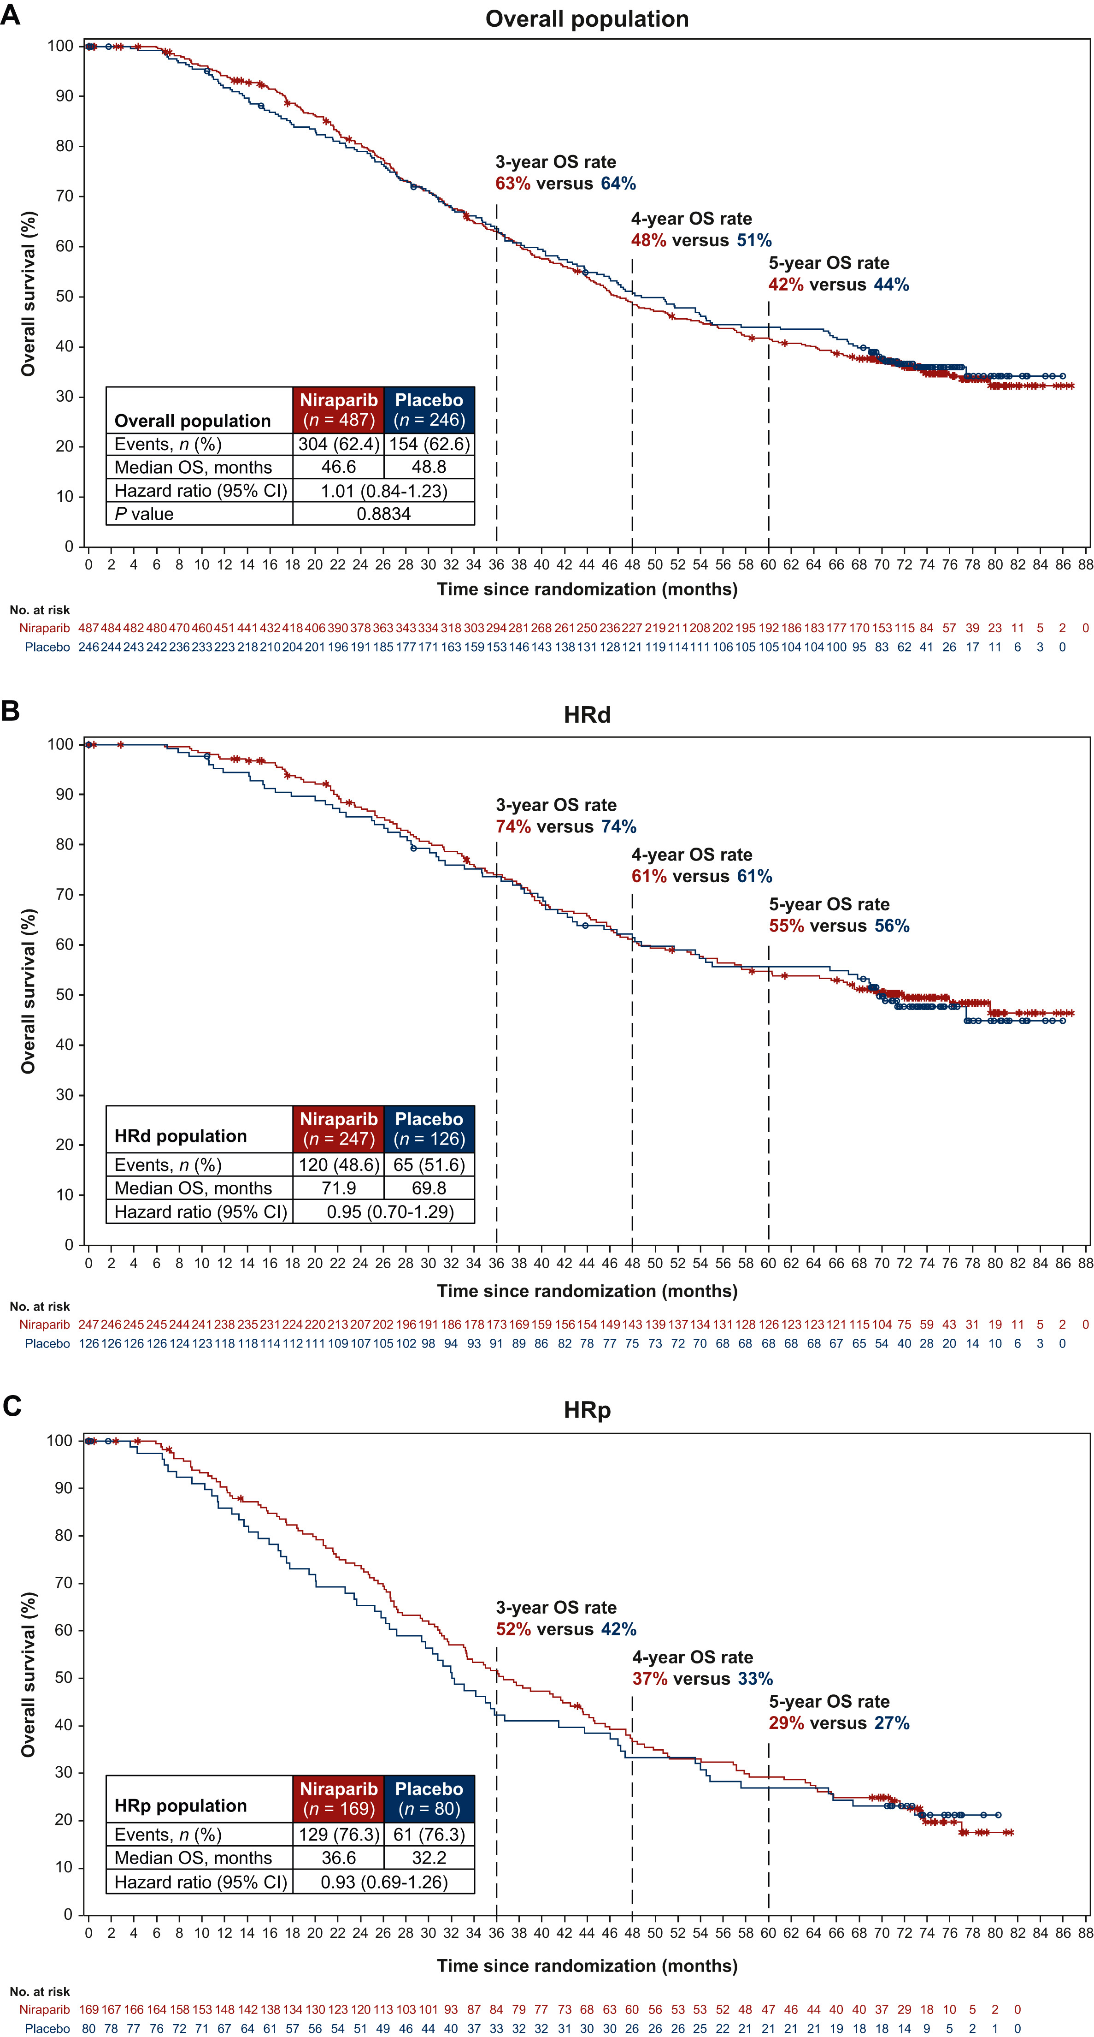
PRIMA
OS results
OS tested in the overall population: NS
So formal OS analysis of
HRD population did not occur
Courtesy of Ursula Matulonis, MD
ESMO 2024, Monk et al, Annals of Oncology 2024

Slide 62
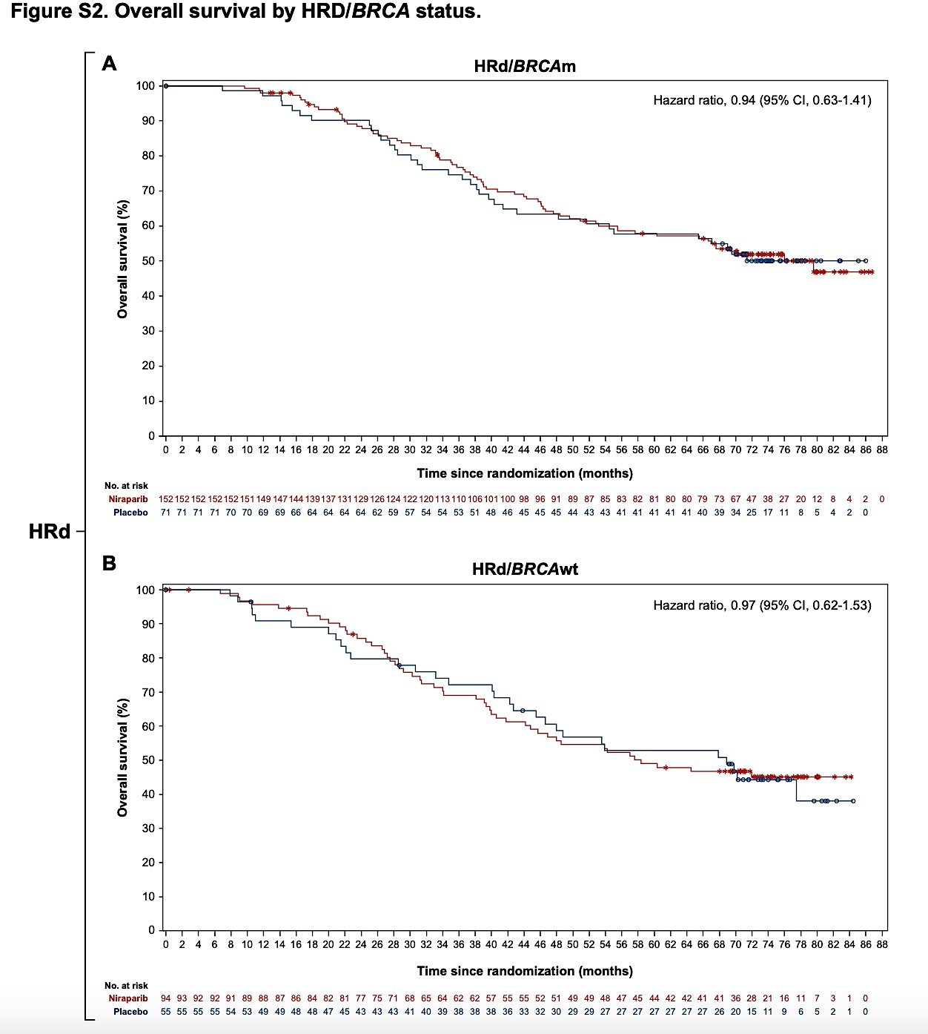
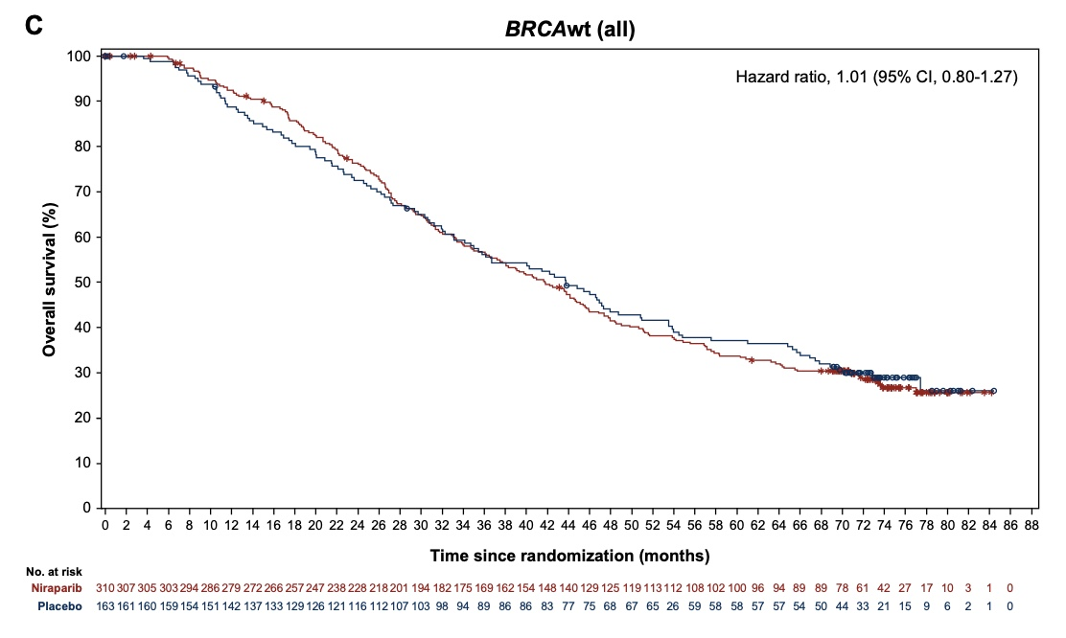
PRIMA OS results
Courtesy of Ursula Matulonis, MD
ESMO 2024, Monk et al, Annals of Oncology 2024

Slide 63
SOLO-1 and PRIMA Trials: Progression-Free and Overall Survival
PRIMA | Niraparib | Placebo | HR (p-value)
Median PFS – Overall* (n = 487, 246) | 13.8 mo | 8.2 mo | 0.66 (NR)
Median PFS – HRd* (n = 247, 146) | 24.5 mo | 11.2 mo | 0.51 (NR)
Median PFS – HRd/BRCAm* (n = 152, 71) | 30.1 mo | 11.5 mo | 0.43 (NR)
Median OS – Overall (n = 487, 246) | 46.6 mo | 48.8 mo | 1.01 (0.8834)
SOLO-1 | Olaparib (n = 260) | Placebo (n = 131)
Median PFS | 56 mo | 13.8 mo
PFS HR (p-value) | 0.33 (not reported)
Median OS | Not reached | 75.2 mo
OS HR (p-value) | 0.55 (0.0004)
PFS = progression-free survival; OS = overall survival; HR = hazard ratio; HRd = homologous recombination deficient; BRCAm = BRCA mutated
* Investigator assessed; NR = not reported
DiSilvestro P et al. ESMO 2022;Abstract 5170; J Clin Oncol 2023;41(3):609-17; Monk BJ et al. Ann Oncol 2024;35(11):981-92; González-Martín A et al ESMO 2024;Abstract LBA29 .

Slide 64
FIRST study
Due to the approvals of PARP inhibitors in the first-line setting, Arm 1 (n=193) was closed and participants were subsequently randomized 1:2 to Arms 2 (n= 385) and 3 (n= 753) only.
Arm 1: SOC chemotherapy followed by placebo maintenance
Primary endpoint: investigator-assessed PFS in Arms 2 and 3. If PFS results were significant, then OS testing would continue
Secondary endpoints: OS, PFS2, time to first and second subsequent therapy.
Pts with PD-L1+ or HRD+ and those with concurrent bevacizumab were identified a priori as clinically “plausible” groups to have differentiated results
Patients with Stage III or IV nonmucinous ovarian
cancer.
Platinum/taxane +/- bev
1:2
Arm 2: SOC chemotherapy +/- bev followed by niraparib maintenance
1:1:2
1162 pts received
either Arm 2 or 3
Arm 3: SOC chemotherapy + dostarlimab +/-bev followed by niraparib and dostarlimab +/- bev maintenance
ASCO 2025
NCT03602859
Courtesy of Ursula Matulonis, MD

Slide 65
FIRST take away points
Essentially the same PFS benefit of adding dostarlimab:
1.4 months difference in median PFS
No overall survival benefit of adding dostarlimab to niraparib maintenance
PD-L1 biomarker did not predict impact of dostarlimab
~50% of patients received bevacizumab; how does receipt of bevacizumab influence therapy outcomes?
Courtesy of Ursula Matulonis, MD

Slide 66
ENGOT 0V43/GOG3036/KEYLYNK-001
ESGO 2025, SGO 2025
Patient population: Advanced non-BRCA mutated newly diagnosed ovarian cancer
Treatment arms:
I) Carboplatin/Paclitaxel
II) Carboplatin/Paclitaxel/Pembrolizumab, followed by Pembrolizumab maintenance
III) Carboplatin/Paclitaxel/Pembrolizumab followed by Pembrolizumab/Olaparib
All arms with or without bevacizumab; no PARPi maintenance alone arm
ESGO 2025 and SGO 2025
Courtesy of Ursula Matulonis, MD

Slide 67
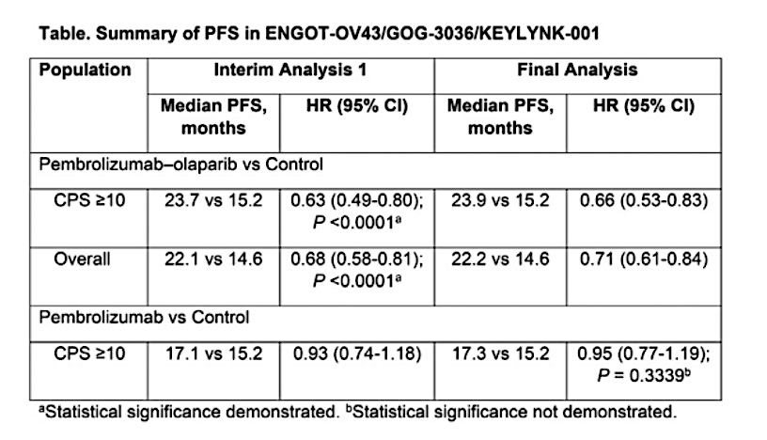
ENGOT 0V43/GOG3036/KEYLYNK-001: findings
PFS benefit for pembrolizumab/olaparib arm compared to chemotherapy alone
No OS benefit
Significance threshold of pembrolizumab versus control in the CPS10 population was not met: thus, formal testing of PFS in the overall population and OS was not performed
ESGO 2025 and SGO 2025
Courtesy of Ursula Matulonis, MD

Slide 68
DUO-O and KEYLYNK studies
Both trials have no PARPi (+/- bev) arms as maintenance and cannot compare the experimental PARP/IO (+/-bev) to SOC PARPi maintenance
Based on these 3 studies – FIRST, DUO-O and KEYLYNK – data does not support adding an IO agent to a PARPi as maintenance nor justification for using an IO in the upfront setting
Courtesy of Ursula Matulonis, MD

Slide 69
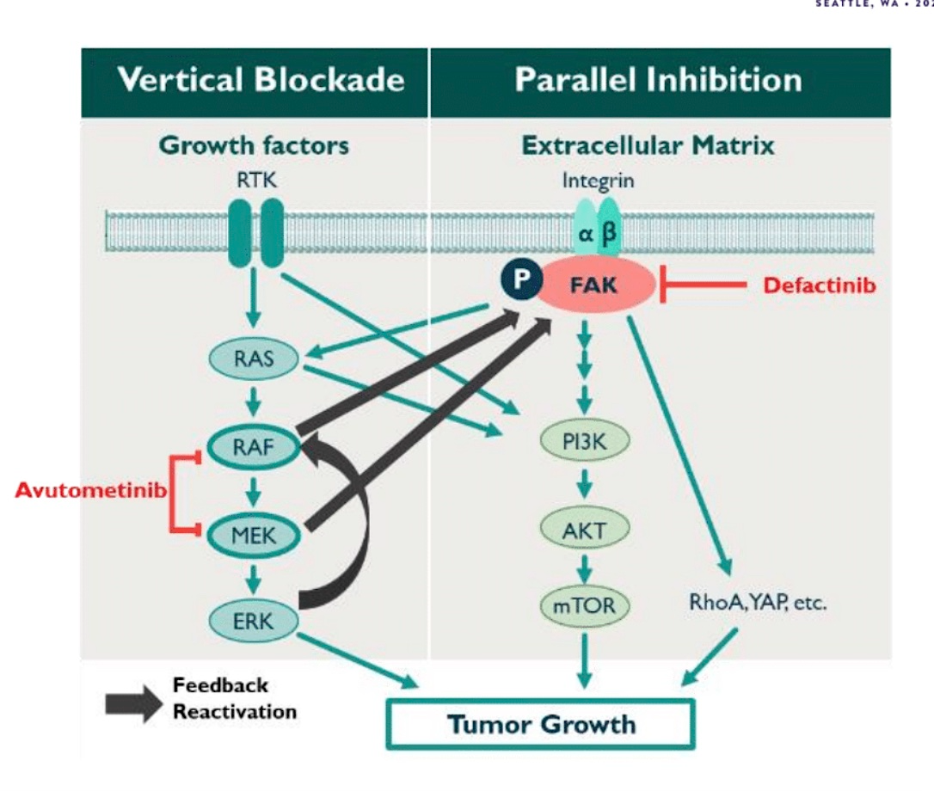
Avutometinib and defactinib for recurrent low grade serous cancer
Combination was granted FDA accelerated approval on
May 7, 2025 for recurrent KRAS mutated LGSC based on RAMP201
Courtesy of Ursula Matulonis, MD

Slide 70
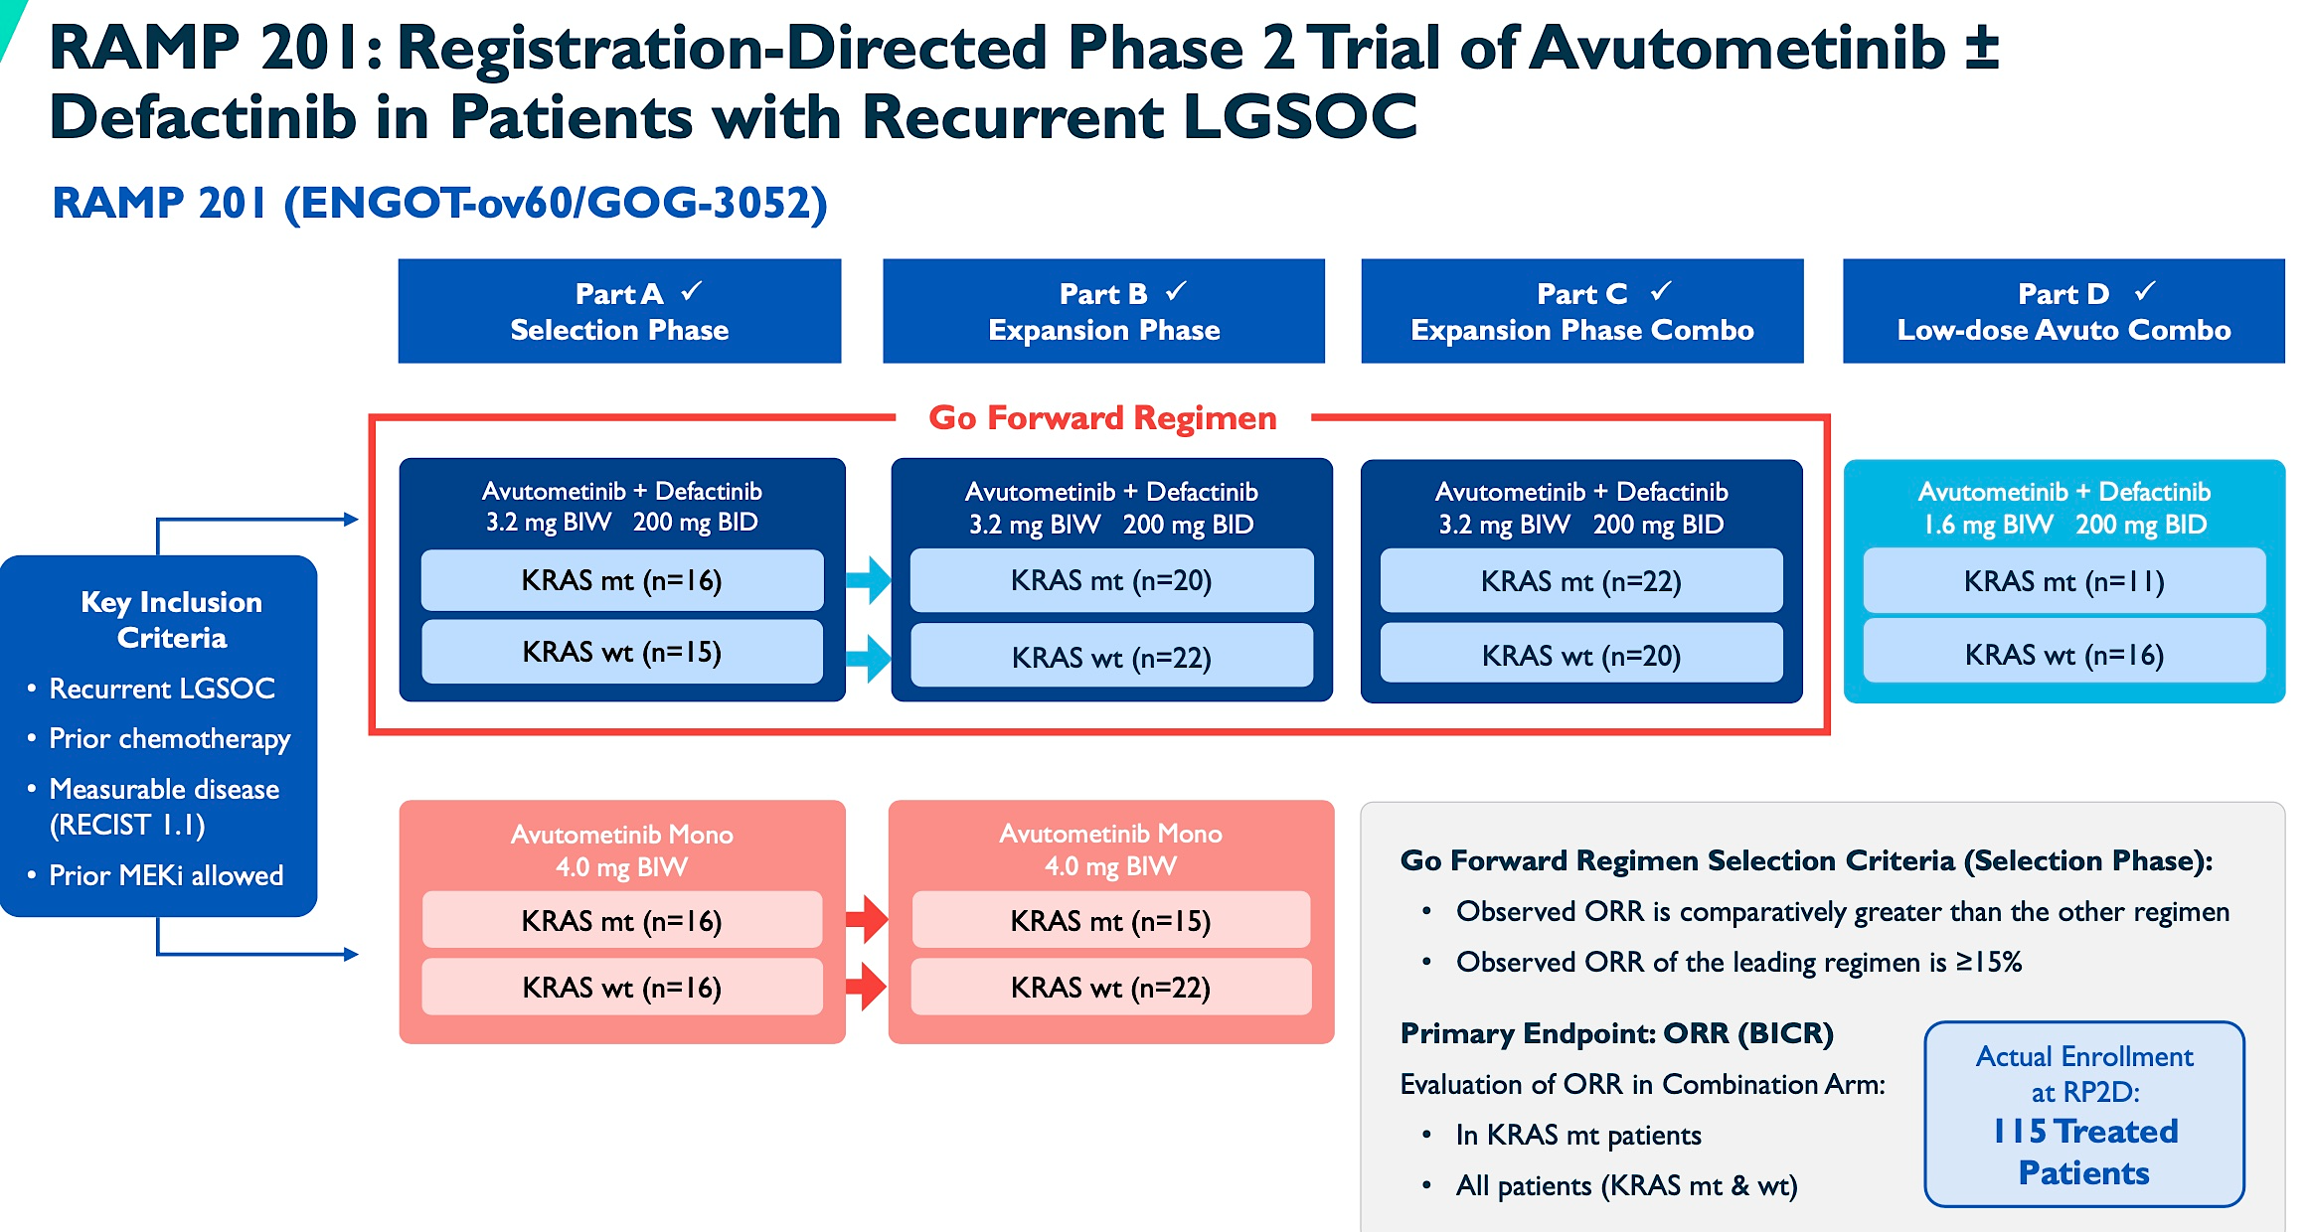
Avutometinib dose 3.2 mg (four
0.8 mg capsules) PO twice per week
(d 1,4). for the first 3 weeks of each
4 week cycle
Defactinib 200 BID PO for 3 weeks
out of 4 weeks
Phase 3 RAMP 301 trial is ongoing (NCT06072781) which is evaluating avutometinib plus defactinib vs investigator’s choice of treatment in patients with recurrent low-grade serous ovarian cancer
IGCS 2024, SGO 2025
Courtesy of Ursula Matulonis, MD

Slide 71
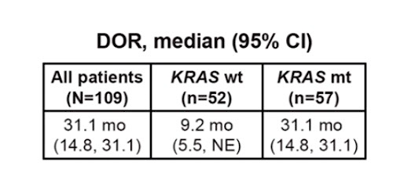
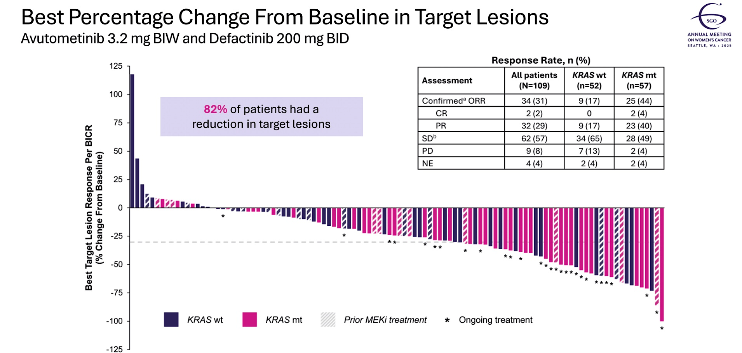
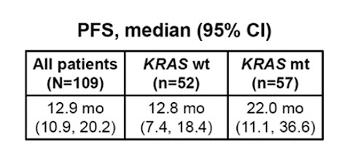
RAMP 201
Grisham et al, SGO 2025
Courtesy of Ursula Matulonis, MD

Slide 72
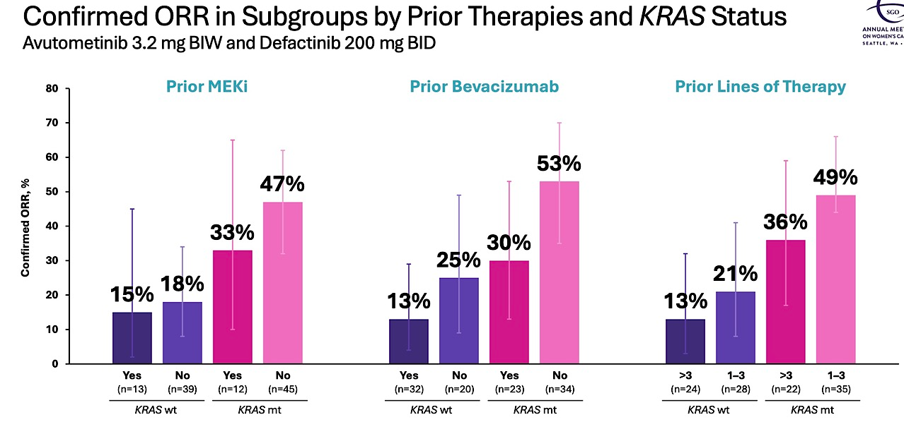
Grisham et al, SGO 2025
Courtesy of Ursula Matulonis, MD

Slide 73
Toxicities
80% of pts had AE’s that led to dose interruption
37% of pts had AE’s that led to dose reduction
10% of pts discontinued treatment because of AE’s
--most common reason was for elevated CPK
Grisham et al, SGO 2025
Courtesy of Ursula Matulonis, MD

Slide 74
ROSELLA study (ASCO 2025, Lancet 2025)
The glucocorticoid receptor (GR) is a nuclear hormone receptor and transcription factor activated by cortisol and glucocorticoid treatment.
Increased glucocorticoid receptor (GR) expression is associated with decreased overall survival in ovarian cancer patients (Veneris et al, 2017, 2019)
In vitro, GR activation inhibits chemotherapy-induced ovarian cancer cell killing in association – thought to occur because of transcriptional upregulation of anti-apoptotic genes.
Hypothesis: modulating/inhibiting GR activity in combination with chemotherapy may improve pt outcomes.
Relacorilant: selective GR modulator
RP2 study (JCO 2023):
Patients were randomly assigned 1:1:1 to:
(1) nab-paclitaxel (80 mg/m²) + intermittent relacorilant (150 mg the day before, of, and after nab-paclitaxel)
(2) nab-paclitaxel (80 mg/m²) + continuous relacorilant (100 mg once daily)
(3) nab-paclitaxel monotherapy (100 mg/m²)
Courtesy of Ursula Matulonis, MD

Slide 75
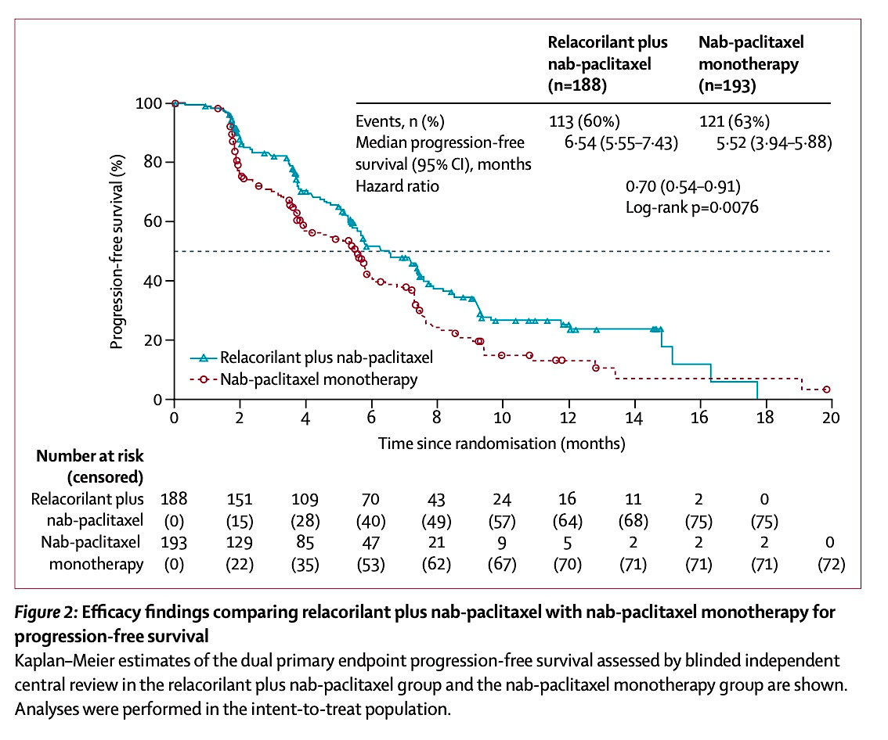
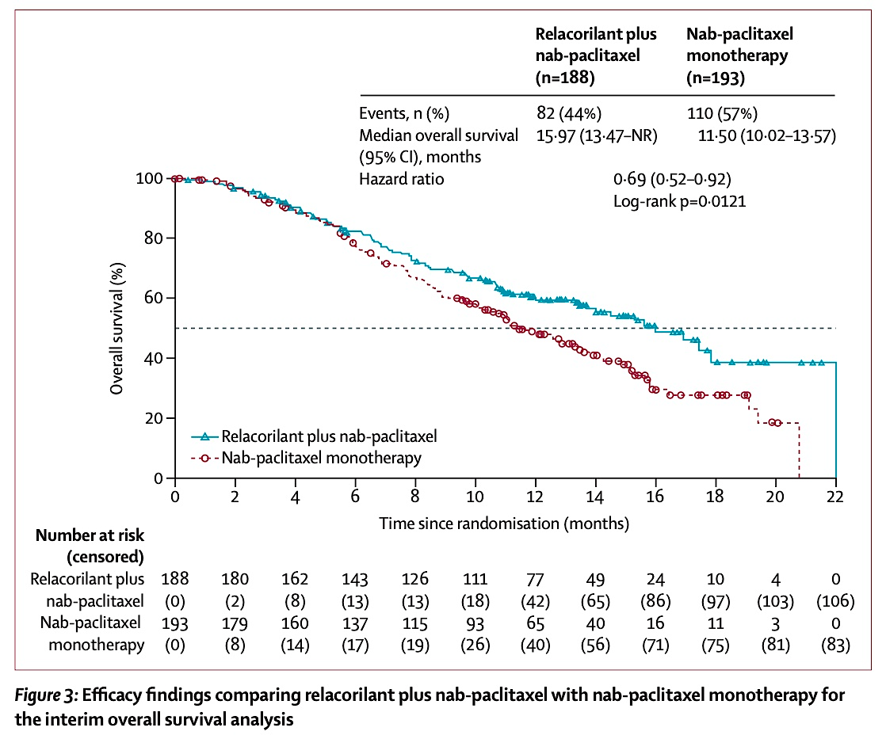
ROSELLA: PFS ROSELLA: OS
ASCO 2025, Lancet 2025
Courtesy of Ursula Matulonis, MD

Slide 76
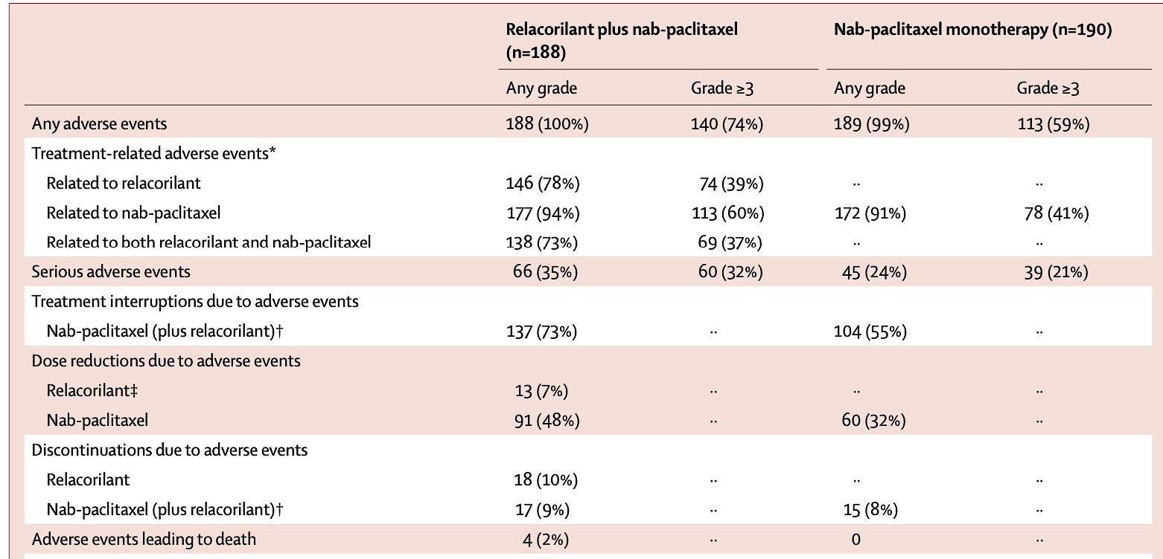
ROSELLA: Toxicities
Higher rate of ≥ grade 3 neutropenia and anemia in the combination arm
Lancet 2025
Courtesy of Ursula Matulonis, MD

Slide 77
Reservations about the ROSELLA study
Lancet paper and ASCO 2025 data represent an interim analysis:
OS benefit is not statistically significant
Very minimal PFS benefit for the experimental arm
Non-blinded study
Nab-paclitaxel is not used standardly
No control over what patients received post treatment
Mix of ovarian cancer histologies enrolled
No quantification of the glucocorticoid receptor
Higher rate of grade 3 or higher neutropenia and anemia in the combination arm
ASCO 2025, Lancet 2025
Courtesy of Ursula Matulonis, MD

Slide 78
Phase 3, randomized, double-blind study of pembrolizumab versus placebo plus paclitaxel with optional bevacizumab for platinum-resistant recurrent ovarian KEYNOTE-B96
Study design:
Pembrolizumab + weekly paclitaxel ± bev vs placebo + weekly paclitaxel ± bev in pts with platinum resistant ovarian cancer
Eligibility:
Histologically confirmed recurrent platinum resistant epithelial ovarian cancer
Up to 1-2 prior lines of systemic therapy, including ≥1 prior platinum-based therapy with ≥4 cycles in first line
Randomization was stratified by:
Planned bev use (yes vs no)
Region (US vs Europe vs rest of world),
PD-L1 status (combined positive score [CPS] <1 vs CPS 1-<10 vs CPS ≥10).
Primary endpoint is PFS by investigator in pts with tumor PD-L1 CPS ≥1 and in all pts.
Secondary endpoints are OS in pts with tumor PD-L1 CPS ≥1 and in all pts, PFS per RECIST v1.1 by BICR in pts with tumor PD-L1 CPS ≥1 and in all pts,
safety and PROs
Courtesy of Ursula Matulonis, MD

Slide 79
KEYNOTE-B96
Planned accrual was 643 pts
Pembro dose: 400 mg IV every 6 weeks
Paclitaxel dose/schedule: 80 mg/m2 per week on a 3 weekly schedule
Press release May 15th 2025:
Trial met its primary endpoint of PFS for platinum-resistant recurrent ovarian cancer whose tumors expressed PD-L1 and in all comers.
The study also met a secondary endpoint of OS in patients whose tumors express PD-L1.
KN100 (Ann Onc 2019)
Pembro alone in plat resistant ovarian cancer:
ORR based on CPS: 4.1% for CPS <1, 5.7% CPS ≥1, and 10.0% for CPS ≥10.
No additional molecular determinants identified for prediction of response (Gyn Onc 2023)
Courtesy of Ursula Matulonis, MD
https://www.merck.com/news/merck-announces-phase-3-keynote-b96-trial-met-primary-endpoint-of-progression-free-survival-pfs-in-patients-with-platinum-resistant-recurrent-ovarian-cancer-whose-tumors-expressed-pd-l1-and-in-all-c/.

Slide 80
Final OS results of MIRASOL
Phase 3 randomized trial of mirvetuximab versus IC’s chemotherapy (weekly paclitaxel, PLD or topotecan)
Eligibility: PROC/high grade serous, FOLR1+, prior bev not mandated, up to 3 prior lines of treatment
Primary platinum refractory ovarian cancer excluded (Primary PFI < 3 months)
Pts randomized 1:1 to mirvetuximab vs IC chemotherapy
Primary endpoint: PFS by investigator
Key secondary endpoint: OS, ORR, mDOR, safety
Van Gorp et al, SGO 2024
Courtesy of Ursula Matulonis, MD

Slide 81
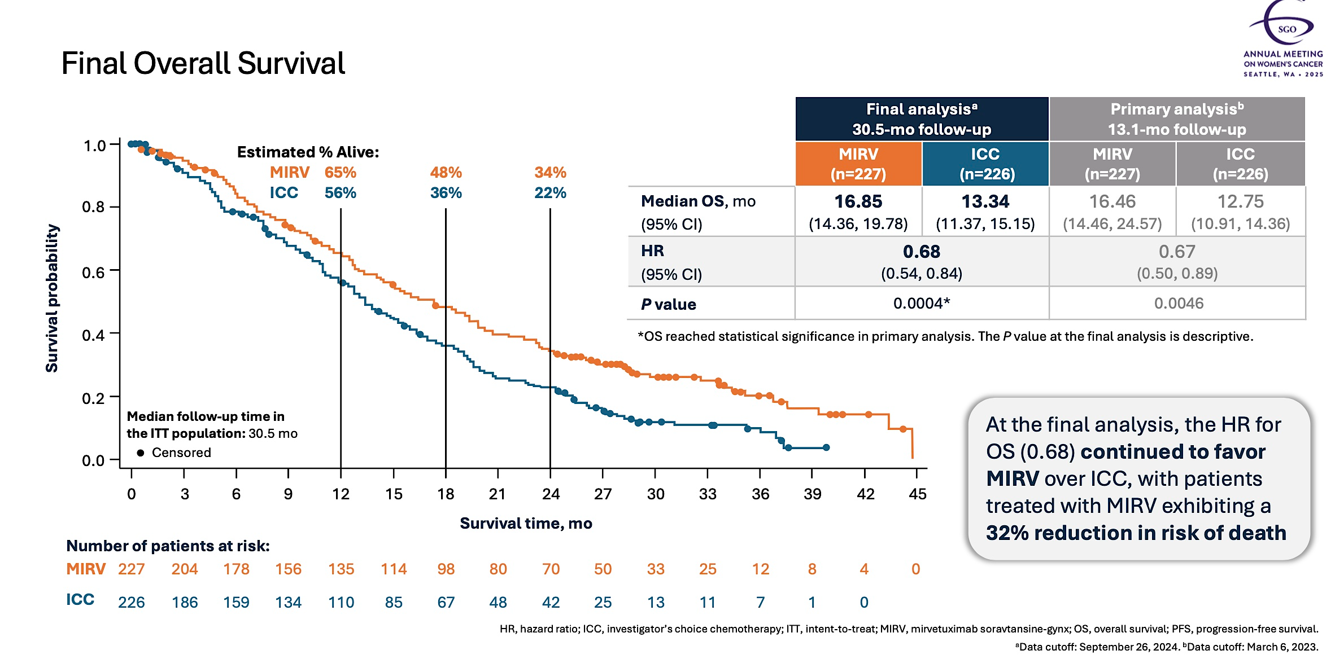
Final OS: First trial in platinum resistant OC to show an OS benefit
Van Gorp et al, SGO 2024
Courtesy of Ursula Matulonis, MD

Slide 82
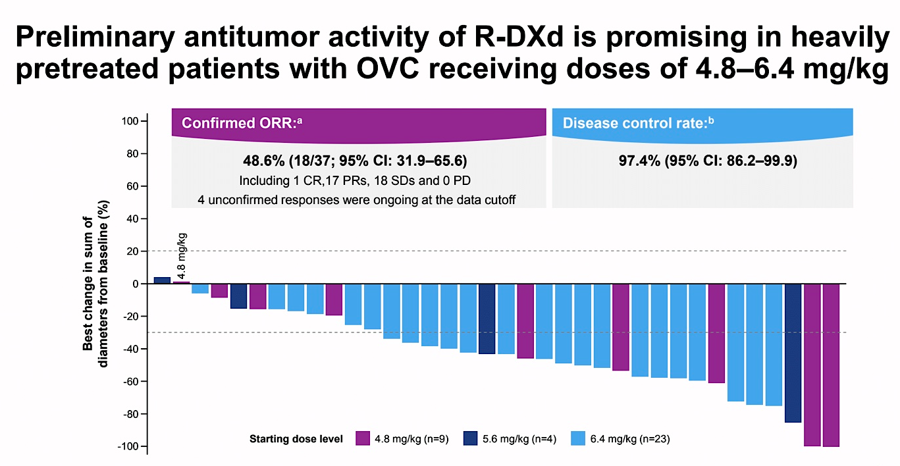
Raludotatug deruxtecan
DAR ~8
Anti-CDH6 ADC
Moore et al, SGO 2024
Courtesy of Ursula Matulonis, MD

Slide 83
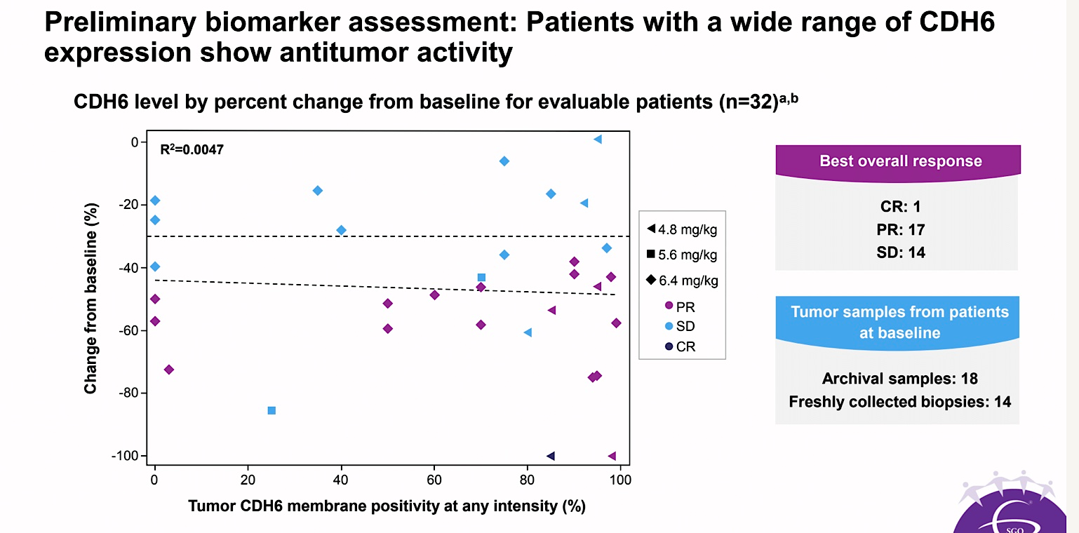
Moore et al, SGO 2024
Courtesy of Ursula Matulonis, MD

Slide 84
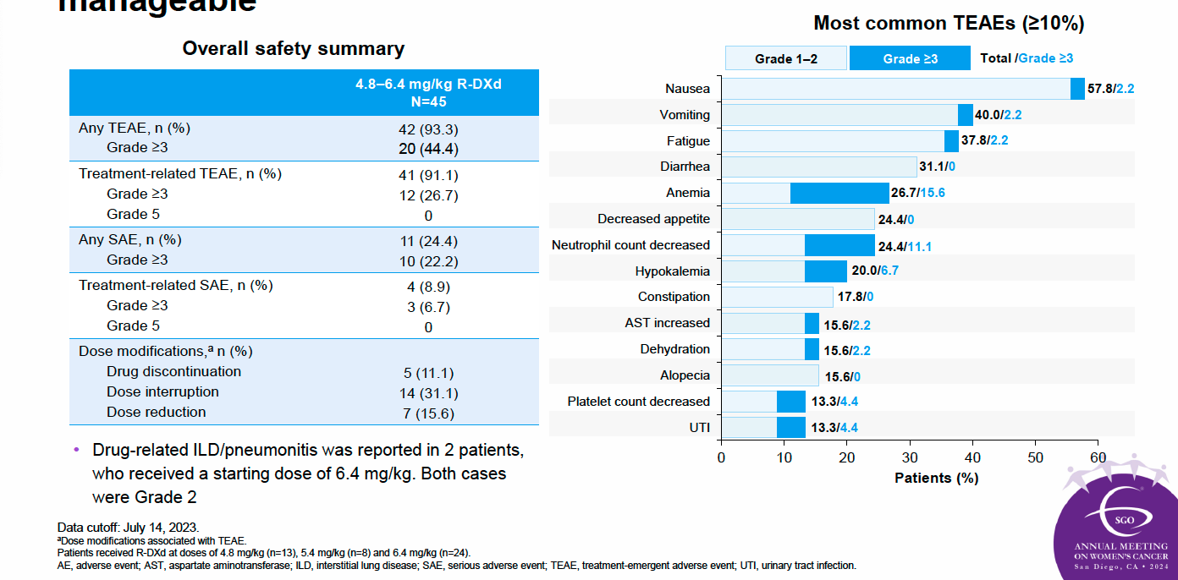
Safety summary: The AE profile of R-DXd appears to be
manageable
60
Moore et al, SGO 2024
Courtesy of Ursula Matulonis, MD

Slide 85
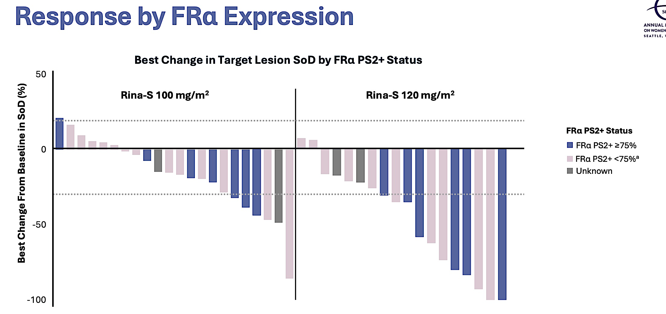
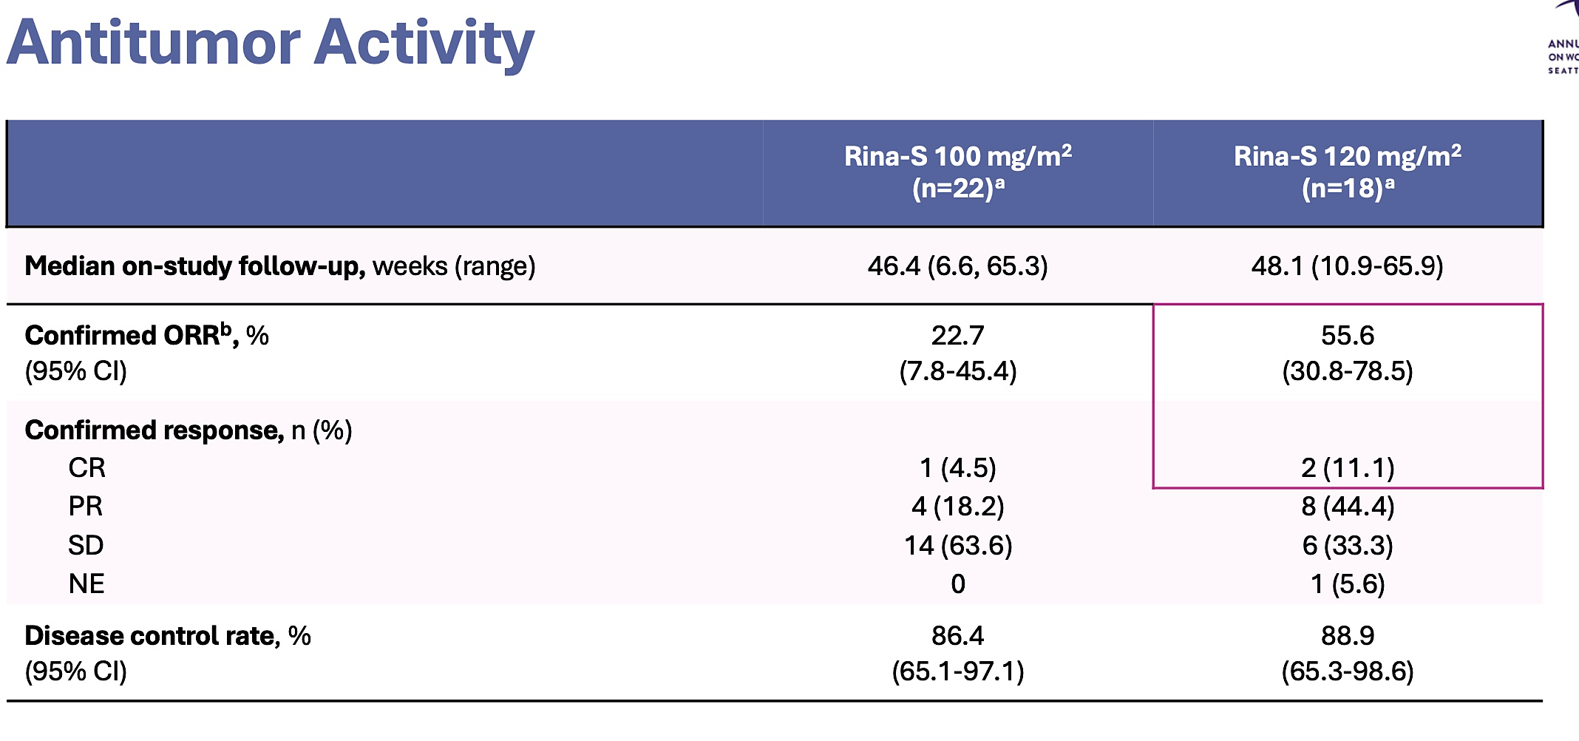
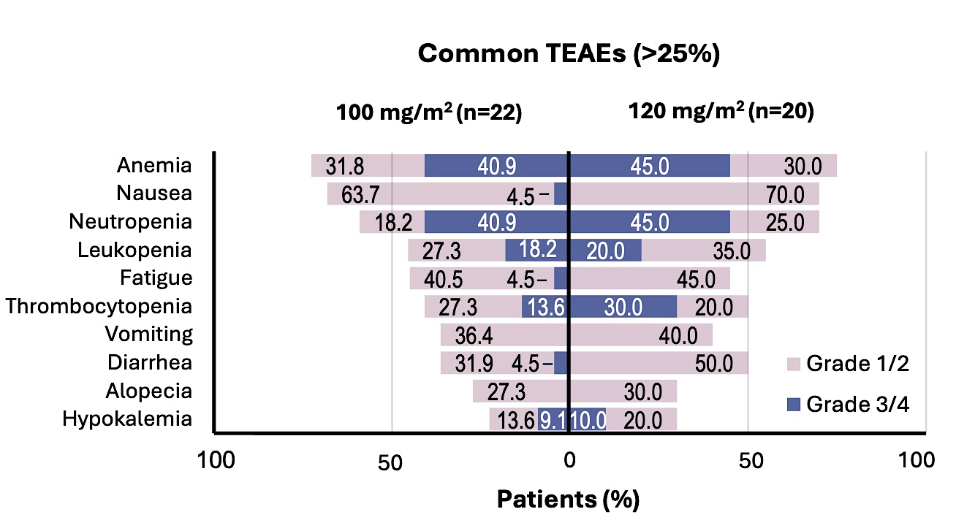
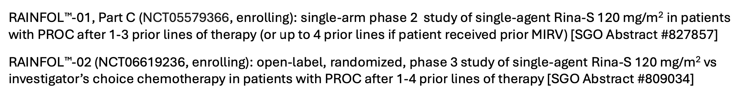
Rinatabart sesutecan
Lee et al, SGO 2025
Courtesy of Ursula Matulonis, MD

Slide 86
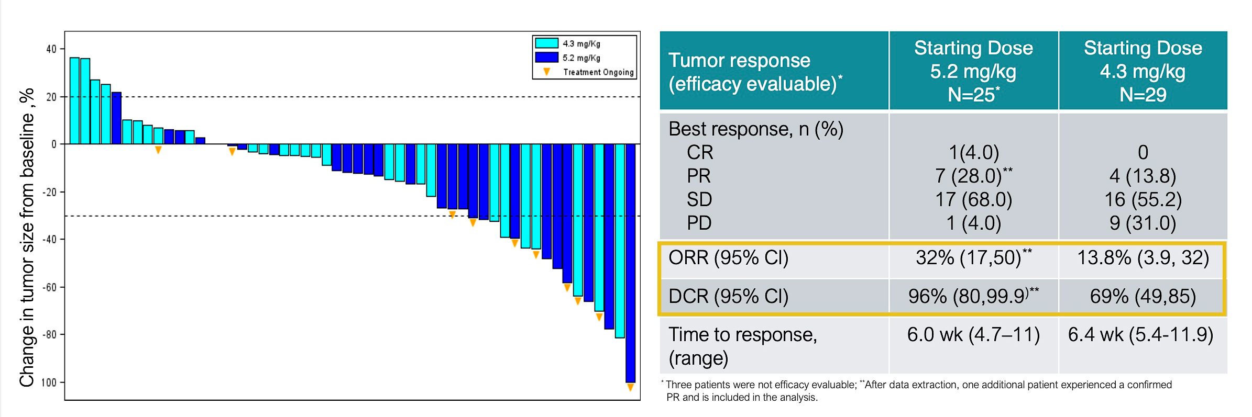
Luveltamab tazevibulin
March 13, 2025 press release:
-The pharmaceutical company will continue to advance exatecan and dual-payload ADC programs; luveltamab tazevibulin development will be deprioritized
March 15, 2025 SGO presentation
Lee et al, SGO 2025
Courtesy of Ursula Matulonis, MD

Slide 87
Phase 2/3 ongoing or planned ADC studies in ovarian cancer
Line of therapy | Phase of trial | Year launched | ADC | Payload | Trial name | Trial design | NCT#
1st line | III | 2025 | Trastuzumab Deruxtecan (HER2) | Topo 1 | ENGOT-ov89/DESTINY-OV-01 | Maintenance HER2+ | NCT06819007
2nd line platinum sensitive | III | not yet | Sacituzumab-tirumotecan (Sac-TMT) (TROP-2) | Topo 1 | ENGOT-ov-84/GEICO141/MK-2870-022 | 2nd line Platinum sens Sac-TMT/bev vs SOC (no biomarker) | NCT06824467
 | III | 2022 | Mirvetuximab (FOLR1) | DM4 | GLORIOSA | Mirvetuximab/bev vs bev alone, as maintenance | NCT05445778
Platinum resistant | II/III | 2023 | Luveltamab tazevibulin (FOLR1) | Topo 1 | ENGOTov79/GEICO134-O/STRO-002-GM3 (REFRaME-01) | up to 4 previous lines, FR𝛂+ | NCT05870748
 | II/III | 2024 | Raludotatug-DXd (CDH6) | Topo 1 | REJOICE-Ovarian01 | up to 3 previous lines, high grade | NCT06161025
 | III | 2024 | Rinatabart sesutecan (FOLR1) | Topo 1 | ENGOT-ov86/GEICO152-O/RAINFOL-OV2 | up to 4 lines high grade | NCT06619236
Courtesy of Ursula Matulonis, MD

Slide 88
Year in Review:
Management of Gynecologic Cancers
INTRODUCTION: Tale of Two Cities — ASCO 2025
MODULE 1: Ovarian Cancer
MODULE 2: HER2-Positive Gynecologic Cancers
MODULE 3: Endometrial Cancer
MODULE 4: Cervical Cancer

Slide 89
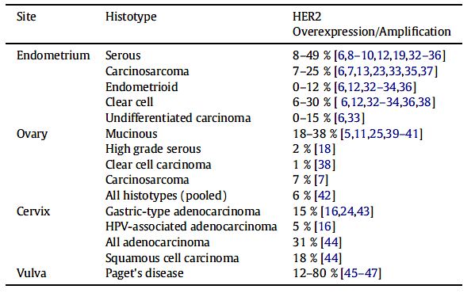
HER2 Overexpression and Amplification Rates in Gynecologic Cancer
Lee EK et al. Gynecol Oncol 2025;195:152-64.

Slide 90
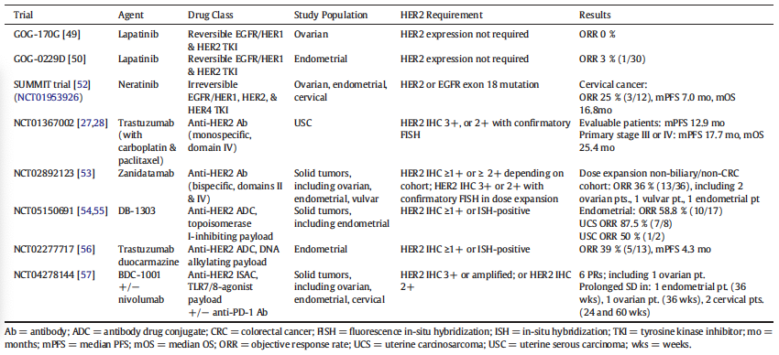
Select Trials of HER2-Targeted Therapies in Gynecologic Cancers
Lee EK et al. Gynecol Oncol 2025;195:152-64.

Slide 91
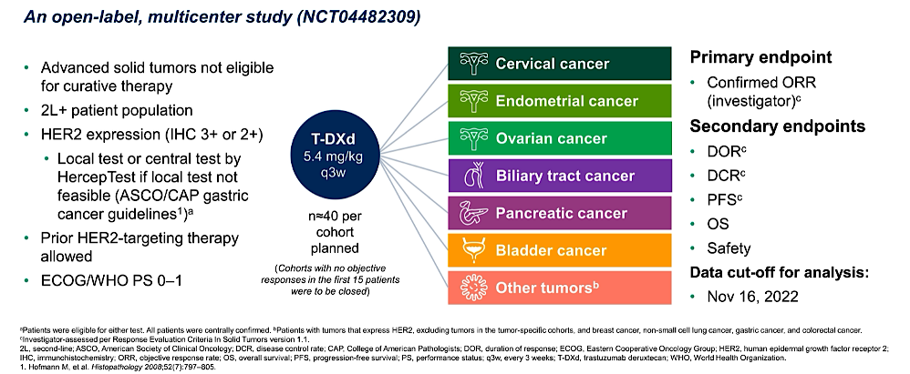
DESTINY-PanTumor02: A Phase II Study of Trastuzumab Deruxtecan (T-DXd) for HER2-Expressing Tumors
Meric-Bernstam F et al. ASCO 2023:Abstract LBA3000.

Slide 92
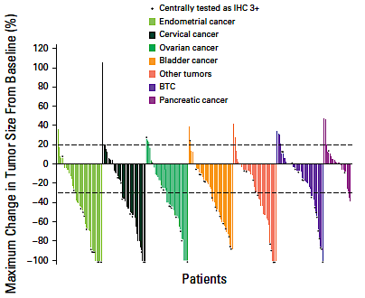
Efficacy of T-DXd: DESTINYPanTumor-02
FDA approval IHC3+ tumour agnostic
Primary endpoint (IHC3+/2+):
Investigator assessed ORR
37.1%
In patients central HER2 3+
RR 61% median DOR 22.1 months
*5 IHC1+ enrolled in cervical cancer
Meric-Bernstam F et al. J Clin Oncol 2024;
42(1):47-58.
Courtesy of Susana Banerjee, MBBS, MA, PhD

Slide 93
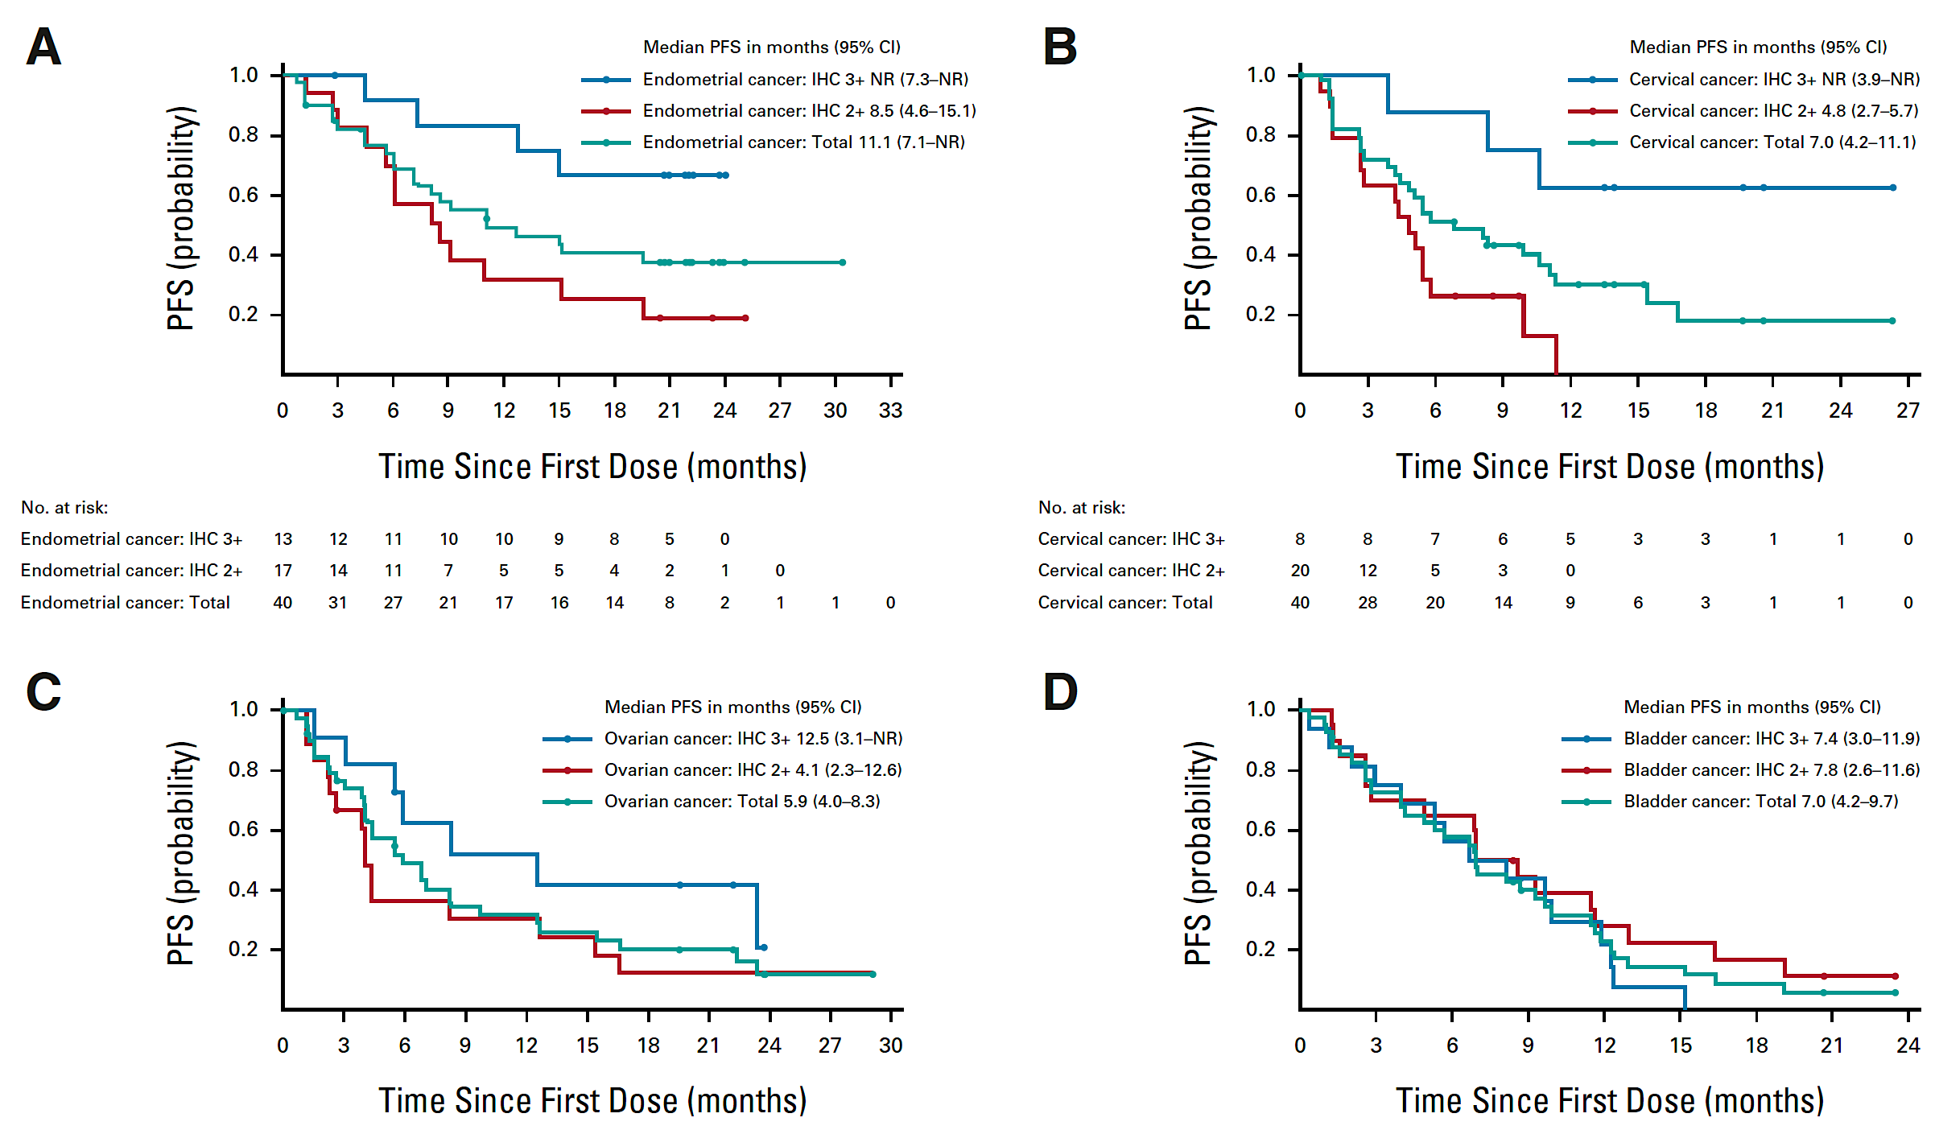
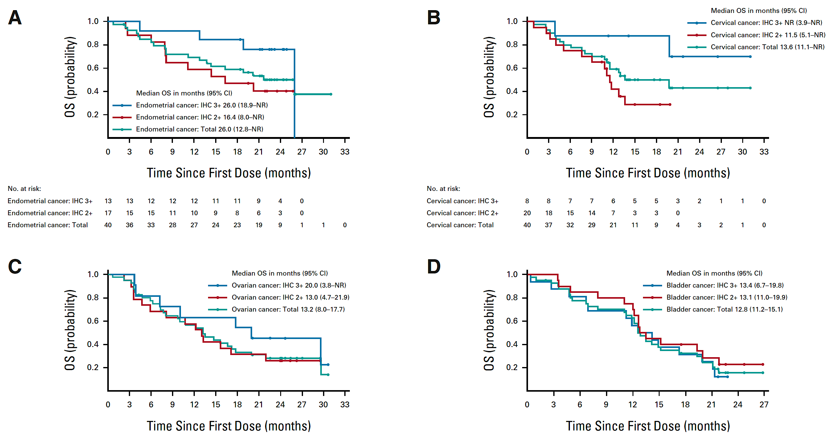
DESTINY-PanTumor02: Survival
Endometrial
Cervical
Ovarian
PFS
OS
Meric-Bernstam F et al. J Clin Oncol 2024;42(1):47-58.

Slide 94
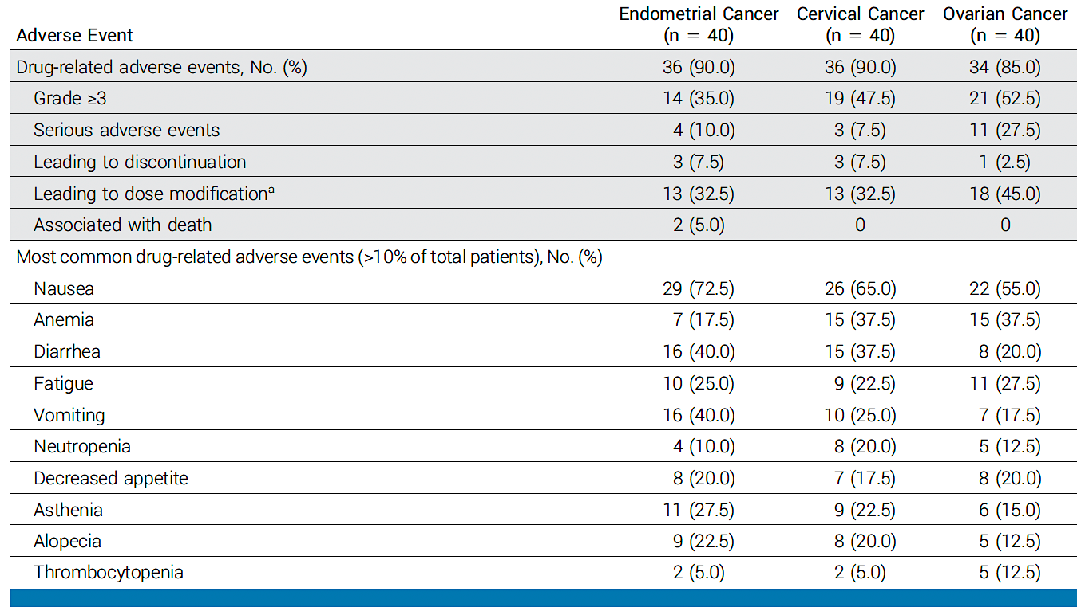
DESTINY-PanTumor02: Adverse Events
Meric-Bernstam F et al. J Clin Oncol 2024;42(1):47-58.

Slide 95
DESTINY-PanTumor02: Response by HER2 Expression Level (Central)
Endometrial cancer
Ovarian cancer
Cervical cancer
Confirmed ORR by INV (%)
IHC Unknown
IHC 3+
IHC 2+
IHC 1+
IHC 0
IHC 3+
IHC 2+
IHC 1+
IHC 0
IHC 3+
IHC 2+
IHC 1+
IHC 0
All
All
All
Total n in subgroup 40 13 7 4 5 1 40 8 20 8 4 40 11 19 5 5
n of responders 23 11 8 1 3 0 20 6 8 4 2 18 7 7 1 3
Median DOR, months NR NR 18.2 NR 9.9 – 14.2 NR 3.8 14.2 NR 11.3 22.1 11.3 8.3 4.5
95% CR 9.9, 9.6, 3.0, – 2.8, – 4.1, 9.3, 2.8, 8.3, 6.8, 4.4, 4.2, 2.8, – 2.6,
NE NE NE NE NE NE NE NE NE 22.1 NE NE NE
ORR = objective response rate; INV = investigator; DOR = duration of response; CR = complete response; NR = not reached; NE = not estimable
Lee J-Y et al. International Gynecological Cancer Society (IGCS) 2023.
Notes:
Trastuzumab deruxtecan (T-DXd) has demonstrated significant survival benefit for patients with HER2-expressing breast and gastric cancers. In DESTINY-PanTumor02, T-DXd demonstrated clinically meaningful response rates, progression-free survival (PFS), and overall survival (OS) in HER2-expressing tumors.
Methods
This open-label, Phase 2 study (NCT04482309) evaluated T-DXd (5.4 mg/kg Q3W) in patients across seven cohorts with HER2-expressing (immunohistochemistry [IHC] 3+/2+ by local [with retrospective central testing] or central testing) locally advanced/metastatic disease after ≥1 systemic treatment, or without alternative treatment. The primary endpoint was investigator-assessed confirmed objective response rate (ORR). Secondary endpoints included duration of response, PFS, OS, and safety. Exploratory endpoints included pharmacodynamic biomarkers.
Results
At data cutoff (June 2023), 120 patients in the endometrial, cervical, and ovarian cancer cohorts had received treatment (median follow-up [range]: 19.94 [0.8–31.1], 12.60 [0.9–31.0], and 13.13 [0.7–30.6] months, respectively). Overall, 80.8% received ≥2 prior lines of therapy. Table 1 shows efficacy outcomes by HER2 expression levels by cohort. Table 2 shows ORR by HER2 in situ hybridization (ISH) amplification and plasma HER2 amplification by cohort. Grade (G)≥3 drug-related adverse events occurred in 54/120 (45.0%) patients; adjudicated treatment-related interstitial lung disease/pneumonitis occurred in 13/120 (10.8%) patients (n=12 G≤2; n=1 G5).
Conclusion/Implications
T-DXd demonstrated clinically meaningful benefit, including responses across HER2 expression levels and in ISH+ or plasma ERBB2 amplified subgroups, and encouraging survival outcomes in patients with gynecological tumors. Safety was consistent with the known profile. These data support T-DXd as a potential treatment for patients with gynecological HER2-expressing tumors who progressed on prior therapy.
Lee J-Y, Makker V, Manso L, et al. Efficacy and safety of trastuzumab deruxtecan in patients with HER2-expressing solid tumors: results from the cervical, endometrial, and ovarian cancer cohorts of the DESTINY-PanTumor02 study. Presented at: Annual Global Meeting of the International Gynecological Cancer Society 2023; November 5-7, 2023; Seoul, North Korea.
https://cslide.ctimeetingtech.com/igcs23/attendee/confcal/session/calendar?q=makker
Slide courtesy D. O’Malley

Slide 96
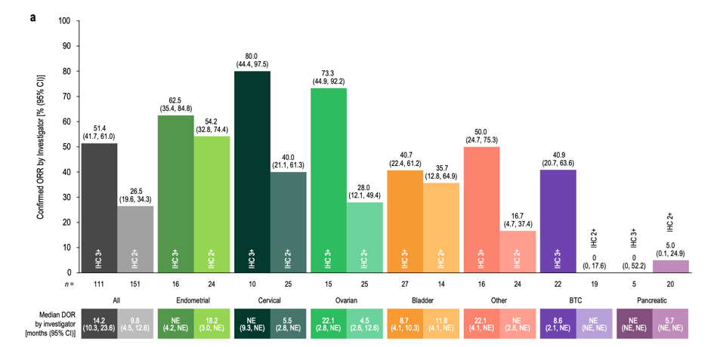
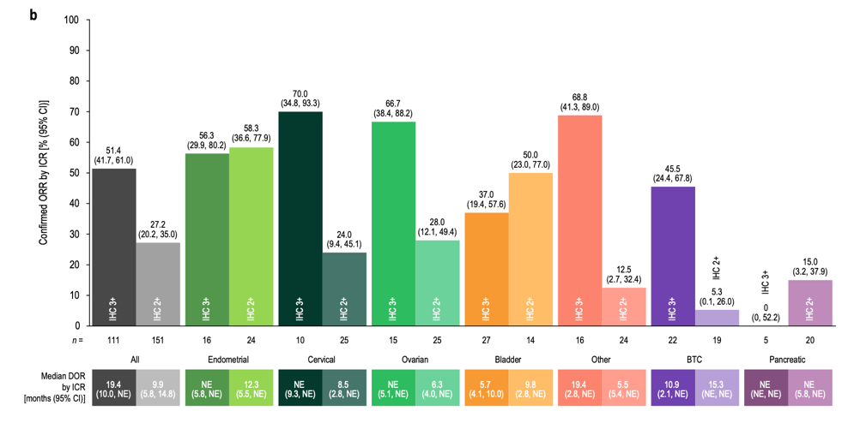
HER2 IHC Status: Efficacy T-DXd DESTINYPanTumor-02
Cervical
Local: IHC 3+ ORR 80%
IHC2+ ORR 40%
Central: IHC 3+ ORR 70%
IHC2+ ORR 24%
Single arm, relatively low numbers
Positive signals
Needs prospective trials/results
Oaknin A et al. Adv Ther 2024;41(11):4125-39.
Courtesy of Susana Banerjee, MBBS, MA, PhD

Slide 97
HER2/neu testing Guidelines for Gynecologic tumors
Clinicians should request HER2 testing on tumor tissue in the biopsy or resection specimens (primary or metastasis) prior to the initiation of trastuzumab/ADC therapy.
When HER2 status is being evaluated, laboratories/pathologists should perform/order IHC testing first, followed by ISH/FISH when IHC result is 2+ (equivocal). Positive (3+) or negative (0 or 1+) HER2 IHC results do not require further ISH/FISH testing.
Pathologists should identify and mark areas with strongest intensity of HER2 expression by IHC in the specimen for subsequent ISH/FISH scoring when required.
The prevalence of HER2 status may be discordant between the primary tumor and metastases in approximately 25% of cases, especially after treatment.
Per NCCN guidelines treating clinicians should offer combination chemotherapy and HER2-targeted therapy as the initial treatment for appropriate patients harboring HER2 positive advanced/recurrent USC and for any gynecologic cancer patient with recurrent tumors demonstrating HER2 2+/3+ expression by IHC.
Courtesy of Alessandro D Santin, MD

Slide 98
Year in Review:
Management of Gynecologic Cancers
INTRODUCTION: Tale of Two Cities — ASCO 2025
MODULE 1: Ovarian Cancer
MODULE 2: HER2-Positive Gynecologic Cancers
MODULE 3: Endometrial Cancer
MODULE 4: Cervical Cancer

Slide 99
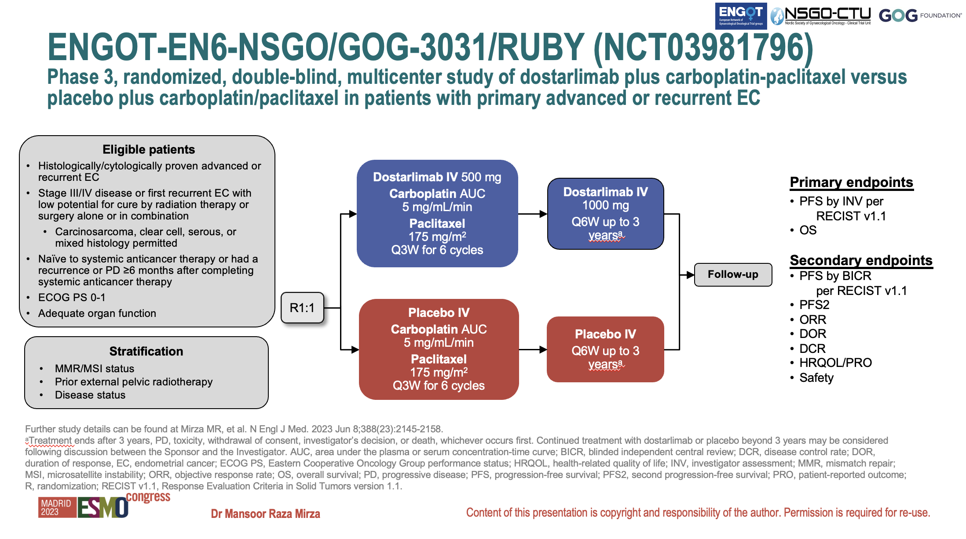
Courtesy of Susana Banerjee, MBBS, MA, PhD

Slide 100
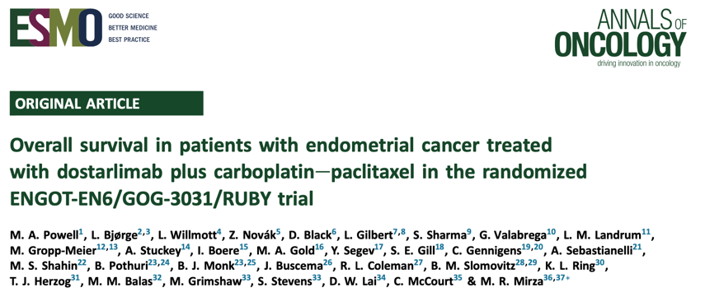
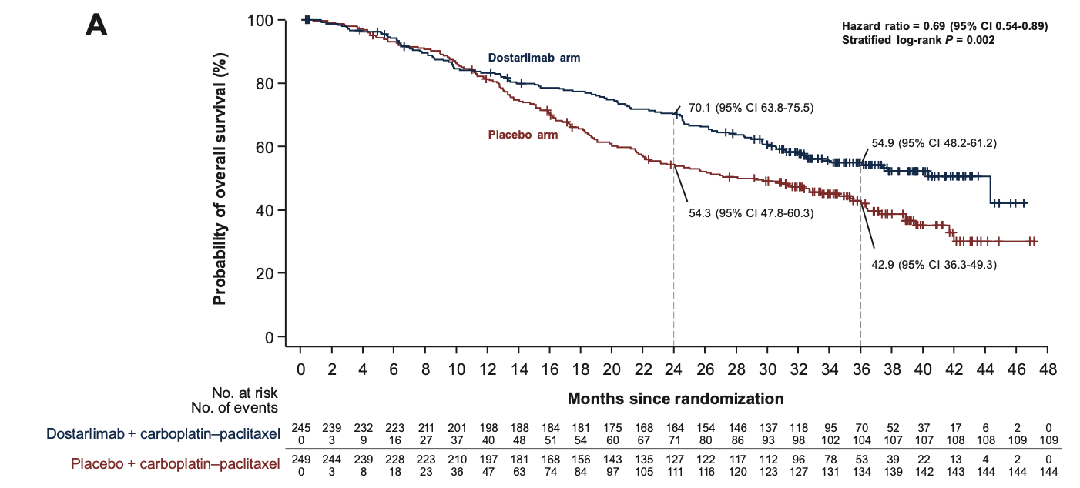
FDA approval (Aug 2024)
EMA approval (2025)
Dostarlimab with carboplatin and paclitaxel, followed by single-agent dostarlimab primary advanced or recurrent endometrial cancer
Regardless of MMR status
494 patients were randomized
(245 in the dostarlimab arm;
249 in the placebo arm)
second interim analysis 51% maturity
Overall population
statistically significant reduction in the risk of death HR 0.69, 95% (CI 0.54- 0.89, p= 0.0020) with addition of dostarlimab plus carboplatin/paclitaxel versus carboplatin/paclitaxel alone
median OS of 44.6 months versus 28.2 months
Courtesy of Susana Banerjee, MBBS, MA, PhD
Powell MA et al. Ann Oncol 2024;35(8):728-38.

Slide 101

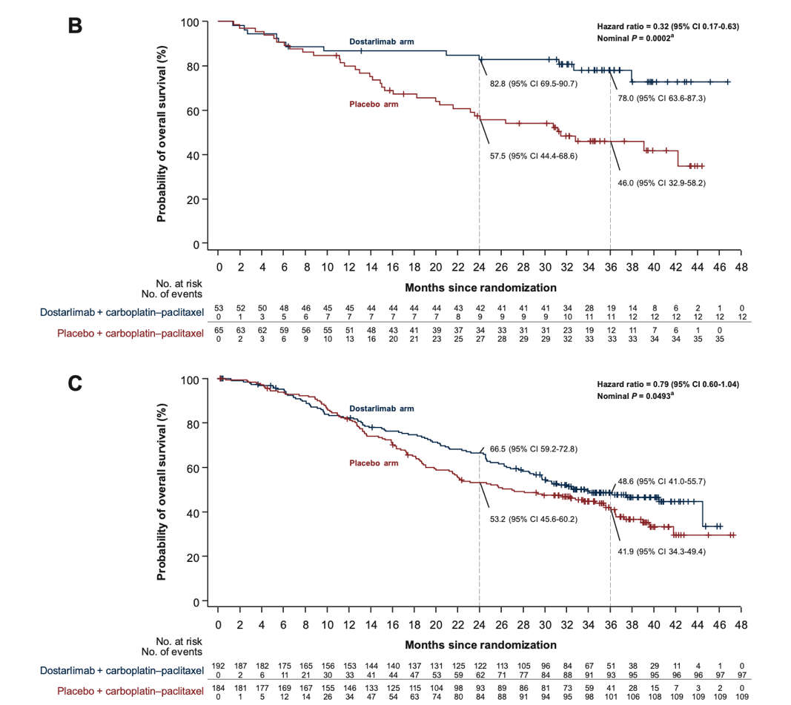
prespecified exploratory analysis.
Risk of death was lower in the dMMR/MSI-H population (HR 0.32, 95% CI 0.17-0.63, nominal P = 0.0002)
Median OS NR vs 31.4 months
trend in favor of dostarlimab was seen in the MMRp/MSS (HR 0.79, 95% CI 0.60-1.04, nominal P=0.0493) median OS 34 vs 27 months
Courtesy of Susana Banerjee, MBBS, MA, PhD
Powell MA et al. Ann Oncol 2024;35(8):728-38.

Slide 102
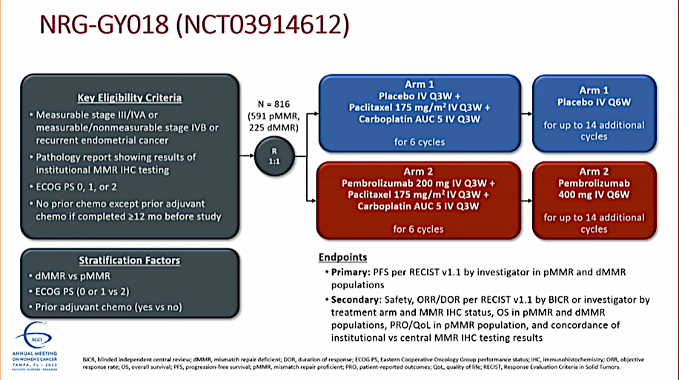
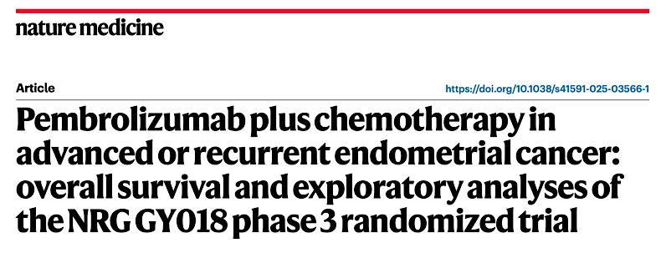

Courtesy of Susana Banerjee, MBBS, MA, PhD
Eskander RN et al. Nat Med 2025 May;31(5):1539-46.
Primary endpoint PFS investigator assessed
ITT
pMMR
Median PFS 13.1 (95% CI, 10.6–19.5) vs 8.7 (95% CI, 8.4– 11.0) months
HR pembrolizumab plus chemotherapy (0.57 (95% CI, 0.44– 0.74); P < 0.0001
dMMR
Median PFS NR vs 8.3 (95% CI, 6.5–12.3) months, HR pembrolizumab plus chemotherapy (0.34 (95% CI, 0.22–0.53); P < 0.0001

Slide 103

NRG GY018 OS secondary endpoint (immature)
Ad hoc analyses (DCO August 2023)
pMMR (46.8% information) HR 0.80 (95% CI, 0.59–1.08; 1-sided nominal P = 0.0683)
dMMR (29.3% information) HR 0.57 (95% CI, 0.31–1.04; 1-sided nominal P = 0.0323)
DCO of KM estimates Dec 2022
Eskander RN et al. Nat Med 2025 May;31(5):1539-46.
Courtesy of Susana Banerjee, MBBS, MA, PhD

Slide 104


Mirza MR et al. ESMO Gynaecological Cancers Congress 2024;Abstract 38MO.
Courtesy of Susana Banerjee, MBBS, MA, PhD

Slide 105


RUBY Trial Part 2: PFS Outcomes
Mirza MR et al. ESMO Gynaecological Cancers Congress 2024;Abstract 38MO.
Courtesy of Susana Banerjee, MBBS, MA, PhD

Slide 106

RUBY Part 2: Role for PARPi?
No Dostarlimab alone arm
What is the magnitude of benefit with
Addition of niraparib?
RUBY part 1 PFS HR (95% CI, 0.16–0.50)
(NEJM 2023)
dMMR/MSI-H 0.28
Overall 0.64 (95% CI, 0.51–0.80)
pMMR/MSS 0.76 (95% CI (0.59-0.98)
Mirza MR et al. ESMO Gynaecological Cancers Congress 2024;Abstract 38MO.
Courtesy of Susana Banerjee, MBBS, MA, PhD

Slide 107
DUO-E met its dual primary endpoints
Randomized, placebo-controlled, double-blind study¹
ITT population: PFS – primary endpoints
6 months
Chemotherapy phase
(six cycles)
Maintenance phase
100
83.9%
83.8%
Patients
Newly diagnosed Stage III/IV or recurrent endometrial cancer
Known MMR status
Naïve to first-line systemic anticancer treatment
Naïve to PARP inhibitors and immune-mediated therapy
All histologies except sarcomas
90
82.5%
12 months
CP
CP
Placebo
80
61.5%
18 months
70
48.5%
60
41.1%
46.3%
37.8%
N=718
PFS (%)
21.7%
50
Durvalumab + olaparib arm
R
1:1:1
CP+D
CP
+
durvalumab
Durvalumab
40
Patients without disease progression
30
Stratified by:
MMR status
(proficient
vs deficient)
Disease status (recurrent vs
newly diagnosed)
Geographic region (Asia vs non-Asia)
20
Durvalumab arm
10
Control arm
CP+D+O
0
CP
+
durvalumab
Durvalumab
+
olaparib
0
3
6
9
12
15
18
21
24
27
30
33
No. at risk
Time since randomization (months)
Durvalumab + olaparib arm
239
214
198
169
139
95
51
30
16
7
3
0
Treatment until disease progression, unacceptable toxicity, or other
discontinuation criteria were met
Durvalumab arm
238
211
188
138
105
69
45
26
13
5
0
0
Control arm
241
213
184
125
86
45
26
10
3
1
1
0
 | Control arm (N=241) | Durvalumab arm (N=238) | Durvalumab + olaparib arm (N=239)
Events, n (%) | 173 (71.8) | 139 (58.4) | 126 (52.7)
Median PFS (95% CI), months | 9.6 (9.0–9.9) | 10.2 (9.7–14.7) | 15.1 (12.6–20.7)
HR (95% CI) vs control |  | 0.71 (0.57–0.89); p=0.003 | 0.55 (0.43–0.69); p<0.0001
Endpoints
Primary (ITT): PFS (RECIST per investigator) in CP+D versus CP and CP+D+O versus CP
Secondary (ITT): OS (key secondary) and safety
Prespecified exploratory analyses: subpopulation analyses of PFS by MMR status
CI, confidence interval; CP, carboplatin + paclitaxel; D, durvalumab; HR, hazard ratio; ITT, intent to treat;
MMR, mismatch repair; O, olaparib; OS, overall survival; PARP, poly(ADP-ribose) polymerase; PFS, progression-free survival; R, randomization; RECIST, Response Evaluation Criteria in Solid Tumors.
1. Westin SN, et al. J Clin Oncol 2024;42:283–99. Kaplan–Meier figure borrowed with permission from Westin SN, et al. Durvalumab plus carboplatin/paclitaxel followed by maintenance durvalumab with or without olaparib as first-line treatment for advanced endometrial cancer: the phase III DUO-E trial. J Clin Oncol 2024;42:283–99: https://ascopubs.org/doi/full/10.1200/JCO.23.02132. © American Society of Clinical Oncology.
Prof. Shannon N. Westin
Abstract 5512
Courtesy of Susana Banerjee, MBBS, MA, PhD

Slide 108
DUO-E: PFS based on mismatch repair status
PFS in the dMMR subpopulation
PFS in the pMMR subpopulation
 | Control (N=49) | D arm (N=46) | D+O arm (N=48)
Events, n (%) | 25 (51.0) | 15 (32.6) | 18 (37.5)
Median PFS (95% CI), months | 7.0 (6.7–14.8) | NR (NR–NR) | 31.8 (12.4–NR)
HR (95% CI) vs control |  | 0.42 (0.22–0.80) | 0.41 (0.21–0.75)
 | Control (N=192) | D arm (N=192) | D+O arm (N=191)
Events, n (%) | 148 (77.1) | 124 (64.6) | 108 (56.5)
Median PFS (95% CI), months | 9.7 (9.2–10.1) | 9.9 (9.4–12.5) | 15.0 (12.4–18.0)
HR (95% CI) vs control |  | 0.77 (0.60–0.97) | 0.57 (0.44–0.73)
6 months
6 months
100
87.2%
100
83.1%
90.6%
12 months
18 months
82.4%
90
73.1%
90
84.4%
12 months
80
70.0%
62.7%
80
67.9%
67.9%
59.4%
18 months
70
43.3%
31.7%
70
44.4%
60
60
40.8%
42.0%
Durvalumab
+ olaparib arm
31.3%
PFS (%)
PFS (%)
20.0%
50
Durvalumab arm
50
40
40
Durvalumab + olaparib arm
30
Control arm
30
Durvalumab arm
20
20
10
10
Control arm
0
0
No. at risk
0
2
4
6
8
10
12
14
16
18
20
22
24
26
28
30
32
0
2
4
6
8
10
12
14
16
18
20
22
24
26
28
30
32
Durvalumab +
olaparib arm
Time since randomization (months)
No. at risk
Time since randomization (months)
48
Durvalumab +
olaparib arm
47
46
46
46
41
41
39
38
37
32
32
32
24
23
23
18
18
16
16
16
10
10
9
4
3
3
2
2
1
1
1
0
191
185
183
168
164
159
157
141
134
132
114
109
Durvalumab arm
46
107
77
75
72
46
46
35
32
31
20
19
19
12
11
10
5
5
4
2
2
0
42
40
37
37
36
36
34
32
31
27
26
26
19
19
19
17
17
14
11
11
9
9
7
5
5
5
2
2
1
0
0
0
Durvalumab arm
192
186
182
174
169
159
152
128
113
107
Control arm
49
83
81
79
53
53
50
36
36
31
27
27
17
15
15
8
7
7
3
2
2
0
0
0
45
43
41
39
29
28
19
17
17
16
15
13
10
9
8
7
7
5
4
4
2
2
2
2
2
2
0
0
0
0
0
0
Control arm
192
184
178
172
170
163
156
126
113
108
77
76
73
44
40
37
25
25
21
13
13
8
7
6
1
1
1
1
1
1
1
1
0
The greatest benefit with CP + durvalumab versus CP was in the dMMR subpopulation¹
In the pMMR subpopulation, the addition of olaparib
further enhanced the PFS benefit¹
Here, we present post hoc exploratory longitudinal circulating tumor (ct)DNA analyses
dMMR, mismatch repair deficient; NR, not reported; pMMR, mismatch repair proficient. 1. Westin SN, et al. J Clin Oncol 2024;42:283–99. Kaplan–Meier figure borrowed with permission from Westin SN, et al. Durvalumab plus carboplatin/paclitaxel followed by maintenance durvalumab with or without olaparib as first-line treatment for advanced endometrial cancer: the phase III DUO-E trial. J Clin Oncol 2024;42:283–99: https://ascopubs.org/doi/full/10.1200/JCO.23.02132. © American Society of Clinical Oncology.
Prof. Shannon N. Westin
Abstract 5512
Courtesy of Susana Banerjee, MBBS, MA, PhD

Slide 109
DUO-E: PFS rate by treatment and baseline ctDNA status in the ITT population
Baseline ctDNA positivity was associated with higher risk of progression across treatment arms
CP arm
CP+D arm
CP+D+O arm
100
100
100
90
90
90
80
80
ctDNA–
80
70
70
70
ctDNA–
60
60
60
PFS (%)
ctDNA–
PFS (%)
PFS (%)
50
50
50
ctDNA+
40
40
ctDNA+
40
30
30
30
Unknown
20
20
Unknown
20
10
No. pts/events
ctDNA+
10
No. pts/events
10
No. pts/events
ctDNA+
94/74
Unknown
ctDNA+
96/51
ctDNA+
88/35
0
ctDNA–
24/9
0
ctDNA–
16/4
0
ctDNA–
29/6
Unknown
123/90
Unknown
126/84
Unknown
122/85
0
2
4
6
8
10
12
14
16
18
20
22
24
26
28
30
32
0
2
4
6
8
10
12
14
16
18
20
22
24
26
28
30
32
0
2
4
6
8
10
12
14
16
18
20
22
24
26
28
30
32
Time since randomization (months)
Time since randomization (months)
Time since randomization (months)
No. at risk
No. at risk
No. at risk
ctDNA+
94
94
94
94
63
42
41
26
17
14
10
5
2
2
1
1
0
ctDNA+
96
95
95
93
75
61
59
41
29
24
22
14
5
4
2
0
0
ctDNA+
88
87
86
85
77
70
67
49
32
23
23
12
7
5
3
1
0
ctDNA–
24
24
24
24
23
19
19
12
8
8
5
3
0
0
0
0
0
ctDNA–
16
16
16
16
15
14
13
11
8
7
5
3
3
3
0
0
0
ctDNA–
29
29
28
28
26
25
25
21
17
14
13
9
4
4
2
0
0
Unknown
123
103
91
66
44
32
26
11
7
4
2
1
1
1
0
0
0
Unknown
126
111
95
79
55
35
33
20
16
14
11
7
5
5
2
0
0
Unknown
122
113
96
85
69
51
47
28
15
14
11
8
5
4
2
2
0
Prof. Shannon N. Westin
Abstract 5512
Courtesy of Susana Banerjee, MBBS, MA, PhD

Slide 110
DUO-E: durvalumab and olaparib mediated ctDNA changes during the maintenance phase (C7D1–C9D1) in pMMR patients
Addition of olaparib may be driving novel anti-tumor activity in pMMR tumors not seen with durvalumab alone
CP (n=102)
CP+D (n=89)
CP+D+O (n=93)
13% clearance
(5/38)
17% clearance
(4/23)
37%
ctDNA+
26%
ctDNA+
23%
ctDNA+
48% clearance
(10/21)
ctDNA–
ctDNA–
ctDNA–
ctDNA–
50%
ctDNA+
36%
ctDNA+
26%
ctDNA+
C7D1
ctDNA–
ctDNA–
C7D1
C7D1
20% rebound
(13/66)
28% rebound
(18/64)
C9D1
C9D1
18% rebound
(13/72)
C9D1
Durvalumab led to 4% more clearance of ctDNA and 8% less rebound, vs CP arm
Addition of olaparib to durvalumab led to 35% more clearance of ctDNA and 10% less rebound, vs CP arm
Prof. Shannon N. Westin
Abstract 5512
Courtesy of Susana Banerjee, MBBS, MA, PhD

Slide 111
Key takeaway points
Baseline ctDNA positivity in DUO-E was associated with increased risk
of progression in all treatment arms
Addition of durvalumab was associated with rapid reductions in ctDNA detection during chemotherapy phase and less rebound of ctDNA during maintenance phase compared with chemotherapy alone
Addition of maintenance olaparib was associated with additional ctDNA clearance, resulting in a further reduction of detectable ctDNA in patients with pMMR tumors
Prof. Shannon N. Westin
Abstract 5512
Courtesy of Susana Banerjee, MBBS, MA, PhD

Slide 112

DUO-E Mismatch Repair-Proficient (pMMR) Subpopulation: Coprevalence of Biomarkers
Moore K et al. SGO 2025;Abstract 922975.

Slide 113

DUO-E pMMR Subpopulation: PFS by Biomarker Subgroup
Moore K et al. SGO 2025;Abstract 922975.

Slide 114
Year in Review:
Management of Gynecologic Cancers
INTRODUCTION: Tale of Two Cities — ASCO 2025
MODULE 1: Ovarian Cancer
MODULE 2: HER2-Positive Gynecologic Cancers
MODULE 3: Endometrial Cancer
MODULE 4: Cervical Cancer

Slide 115

ENGOT-cx11/GOG-3047/KEYNOTE-A18:<br />Randomized, Double-Blind, Phase 3 Study
FDA and EMA approval
Duska LR et al. ASCO 2025;Abstract LBA5504.
Content of this presentation is the property of the author, licensed by ASCO. Permission required for reuse.
Courtesy of Susana Banerjee, MBBS, MA, PhD

Slide 116

Primary Endpoint: Progression-Free Survival at Interim Analysis 1
KEYNOTE-A18
Duska LR et al. ASCO 2025;Abstract LBA5504.
Content of this presentation is the property of the author, licensed by ASCO. Permission required for reuse.
Courtesy of Susana Banerjee, MBBS, MA, PhD

Slide 117

Descriptive Overall Survival at Final Analysis
KEYNOTE-A18
Duska LR et al. ASCO 2025;Abstract LBA5504.
Content of this presentation is the property of the author, licensed by ASCO. Permission required for reuse.
Courtesy of Susana Banerjee, MBBS, MA, PhD

Slide 118

CALLA Study Design
Mayadev J et al. ASCO 2025;Abstract 5502.
Courtesy of Susana Banerjee, MBBS, MA, PhD

Slide 119

CALLA Study Background
Mayadev J et al. ASCO 2025;Abstract 5502.
Courtesy of Susana Banerjee, MBBS, MA, PhD

Slide 120




Mayadev J et al. ASCO 2025;Abstract 5502.
Courtesy of Susana Banerjee, MBBS, MA, PhD

Slide 121


Conclusions
Next steps:
Integrating prospectively in to clinical
Trials?
Mayadev J et al. ASCO 2025;Abstract 5502.
Courtesy of Susana Banerjee, MBBS, MA, PhD

Slide 122


1st ADC FDA approved in gynae cancers
Vergote I et al. N Engl J Med 2024;391(1):44-55.
Courtesy of Susana Banerjee, MBBS, MA, PhD

Slide 123



innovaTV 301: Tisotumab Vedotin in recurrent Cervical Cancer
Vergote I et al. N Engl J Med 2024;391(1):44-55; Vergote I et al. ESMO 2023. Abstract LBA9.
Courtesy of Susana Banerjee, MBBS, MA, PhD

Slide 124


innovaTV 301: Tisotumab Vedotin Adverse Events
Vergote I et al. ESMO 2023. Abstract LBA9.
Courtesy of Susana Banerjee, MBBS, MA, PhD

Slide 125
Tisotumab vedotin showed a statistically significant and clinically meaningful improvement in OS
The hazard ratio for OS was 0.70, demonstrating a 30% reduction in the risk of death
Adverse events – recognition of ocular toxicity
Step forward – prognosis remains poor: need to further improve outcomes in recurrent cervical cancer
Courtesy of Susana Banerjee, MBBS, MA, PhD

Slide 126
Year in Review: Clinical Investigator Perspectives on the
Most Relevant New Datasets and Advances in Oncology
Nontargeted Approaches for Lung Cancer
A CME/MOC-Accredited Live Webinar
​Tuesday,​ June 24, 2025
5:00 PM – 6:00 PM ET
Faculty
Benjamin Levy, MD
Moderator
Neil Love, MD

Slide 127
Thank you for joining us!
Please take a moment to complete the survey currently up on Zoom. Your feedback is very important to us. The survey will remain open for 5 minutes after the meeting ends.
Information on how to obtain CME, ABIM MOC and ABS credit is provided in the Zoom chat room. Attendees will also receive an email in
1 to 3 business days with these instructions.

