Slide 1
Cancer Q&A: Addressing Common Questions Posed by Patients with Relapsed/Refractory Multiple Myeloma
A Live Webinar for Patients, Developed in Partnership with CancerCare®
Wednesday, July 23, 2025 6:00 PM – 7:00 PM ET
Faculty
Natalie S Callander, MD
Sagar Lonial, MD, FACP
Moderator
Neil Love, MD

Slide 2
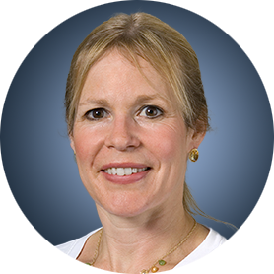
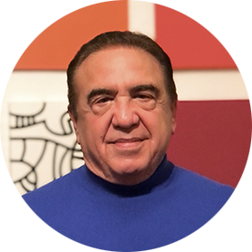
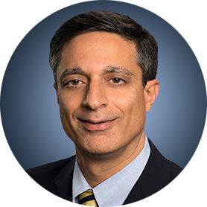
Faculty
Natalie S Callander, MD
Director, Myeloma Clinical Program
University of Wisconsin Carbone Cancer Center
Madison, Wisconsin
MODERATOR
Neil Love, MD Research To Practice Miami, Florida
Sagar Lonial, MD, FACP
Chair and Professor
Department of Hematology and Medical Oncology
Chief Medical Officer
Winship Cancer Institute
Emory University School of Medicine
Atlanta, Georgia

Slide 3
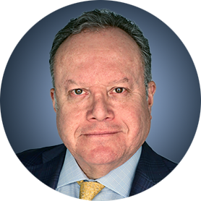
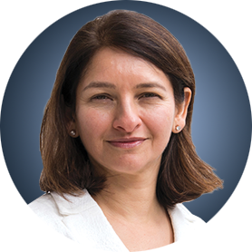
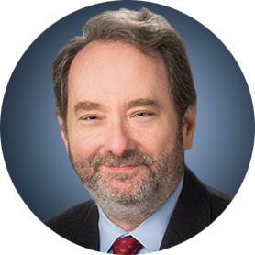
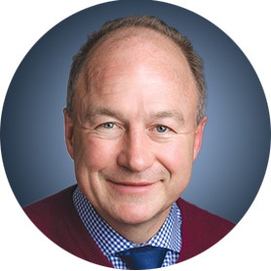
Survey Participants
Rafael Fonseca, MD
Chief Innovation Officer
Getz Family Professor of Cancer
Distinguished Mayo Investigator
Mayo Clinic in Arizona
Phoenix, Arizona
Noopur Raje, MD
Director, Center for Multiple Myeloma
Rita Kelley Chair in Oncology
Massachusetts General Hospital Cancer Center
Professor of Medicine
Harvard Medical School
Boston, Massachusetts
Robert Z Orlowski, MD, PhD
Florence Maude Thomas Cancer Research Professor
Department of Lymphoma and Myeloma
Professor, Department of Experimental Therapeutics
Vice Chair, Myeloma Translational Research
Division of Cancer Medicine
The University of Texas MD Anderson Cancer Center
Houston, Texas
Paul G Richardson, MD
Clinical Program Leader and Director of Clinical Research
Jerome Lipper Multiple Myeloma Center
Dana-Farber Cancer Institute
RJ Corman Professor of Medicine
Harvard Medical School
Boston, Massachusetts

Slide 4
Commercial Support
This activity is supported by an educational grant from GSK.

Slide 5
Dr Love — Disclosures
Dr Love is president and CEO of Research To Practice. Research To Practice receives funds in the form of educational grants to develop CME activities from the following companies: Aadi Bioscience, AbbVie Inc, ADC Therapeutics, Alexion Pharmaceuticals, Amgen Inc, Array BioPharma Inc, a subsidiary of Pfizer Inc, Arvinas, Astellas, AstraZeneca Pharmaceuticals LP, Aveo Pharmaceuticals, Bayer HealthCare Pharmaceuticals, BeOne, Black Diamond Therapeutics Inc, Blueprint Medicines, Boehringer Ingelheim Pharmaceuticals Inc, Bristol Myers Squibb, Clovis Oncology, Coherus BioSciences, CTI BioPharma, a Sobi Company, Daiichi Sankyo Inc, Eisai Inc, Elevation Oncology Inc, Exact Sciences Corporation, Exelixis Inc, Genentech, a member of the Roche Group, Genmab US Inc, Geron Corporation, Gilead Sciences Inc, GSK, Hologic Inc, ImmunoGen Inc, Incyte Corporation, Ipsen Biopharmaceuticals Inc, Jazz Pharmaceuticals Inc, Johnson & Johnson, Karyopharm Therapeutics, Kite, A Gilead Company, Kura Oncology, Legend Biotech, Lilly, MEI Pharma Inc, Merck, Mersana Therapeutics Inc, Mirati Therapeutics Inc, Mural Oncology Inc, Natera Inc, Novartis, Novartis Pharmaceuticals Corporation on behalf of Advanced Accelerator Applications, Novocure Inc, Nuvalent, Pfizer Inc, Pharmacyclics LLC, an AbbVie Company, Puma Biotechnology Inc, Regeneron Pharmaceuticals Inc, Rigel Pharmaceuticals Inc, R-Pharm US, Sanofi, Seagen Inc, Servier Pharmaceuticals LLC, SpringWorks Therapeutics Inc, Stemline Therapeutics Inc, Syndax Pharmaceuticals, Taiho Oncology Inc, Takeda Pharmaceuticals USA Inc, TerSera Therapeutics LLC, and Tesaro, A GSK Company.

Slide 6
Research To Practice CME Planning Committee Members, Staff and Reviewers
Planners, scientific staff and independent reviewers for Research To Practice have no relevant conflicts of interest to disclose.

Slide 7
Dr Callander — Disclosures Faculty
No relevant conflicts of interest to disclose.

Slide 8
Dr Lonial — Disclosures Faculty
Advisory Committees and Consulting Agreements | AbbVie Inc, Amgen Inc, Bristol Myers Squibb, Genentech, a member of the Roche Group, GSK, Janssen Biotech Inc, Novartis, Pfizer Inc, Regeneron Pharmaceuticals Inc, Takeda Pharmaceuticals USA Inc
Boards of Directors | TG Therapeutics Inc
Contracted Research | Bristol Myers Squibb, Janssen Biotech Inc, Novartis, Takeda Pharmaceuticals USA Inc
Stock Options/Stock — Public Companies | TG Therapeutics Inc

Slide 9
Dr Fonseca — Disclosures Survey Participant
Boards of Directors | Antengene
Consulting Agreements | AbbVie Inc, Adaptive Biotechnologies Corporation, Amgen Inc, Apple, Bristol Myers Squibb, Celgene Corporation, GSK, Janssen Biotech Inc, Karyopharm Therapeutics, Pfizer Inc, RA Capital Management, Regeneron Pharmaceuticals Inc, Sanofi
Data and Safety Monitoring Boards/Committees | Bristol Myers Squibb
Patents (Through Institution) | Abbott
Scientific Advisory Boards | Caris Life Sciences
Stock Options/Stock — Public Companies | Antengene, Caris Life Sciences

Slide 10
Dr Orlowski — Disclosures Survey Participant
Advisory Committees and Consulting Agreements | AbbVie Inc, Adaptive Biotechnologies Corporation, Asylia Therapeutics Inc, Biotheryx, Bristol Myers Squibb, CellCentric, DEM BioPharma, IASO Bio, Karyopharm Therapeutics, Lytica Therapeutics, Meridian Therapeutics, Monte Rosa Therapeutics, MYELOMA360, Neoleukin Therapeutics Inc, Oncopeptides, Pfizer Inc, Regeneron Pharmaceuticals Inc, Sanofi, Takeda Pharmaceuticals USA Inc
Stock Options — Private Companies | Asylia Therapeutics Inc

Slide 11
Dr Raje — Disclosures Survey Participant
Advisory Committees | Advisor to AstraZeneca Pharmaceuticals LP, Bristol Myers Squibb, Genentech, a member of the Roche Group, GSK, Johnson & Johnson, Pfizer Inc, Sanofi

Slide 12
Dr Richardson — Disclosures Survey Participant
Consulting Agreements | Bristol Myers Squibb, Celgene Corporation, GSK, Karyopharm Therapeutics, Oncopeptides, Regeneron Pharmaceuticals Inc, Sanofi
Contracted Research | Oncopeptides

Slide 13
This educational activity contains discussion of non-FDA-approved uses of agents and regimens. Please refer to official prescribing information for each product for approved indications.

Slide 14
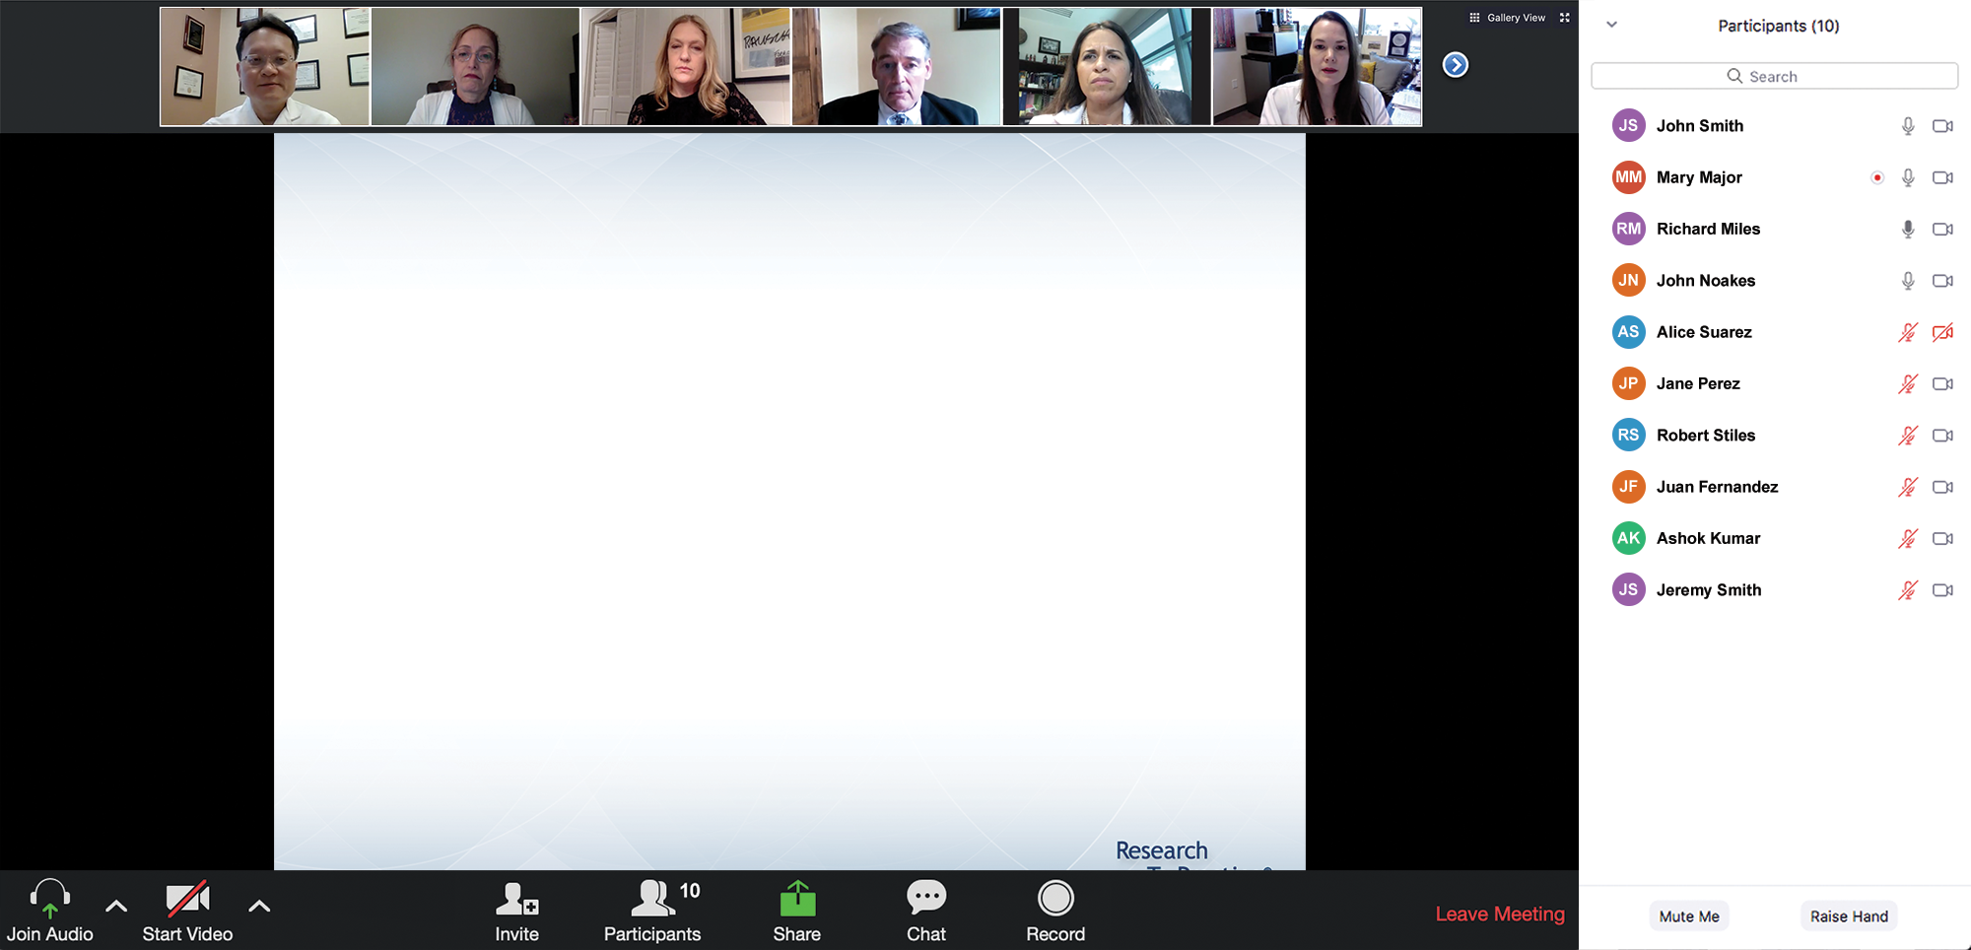
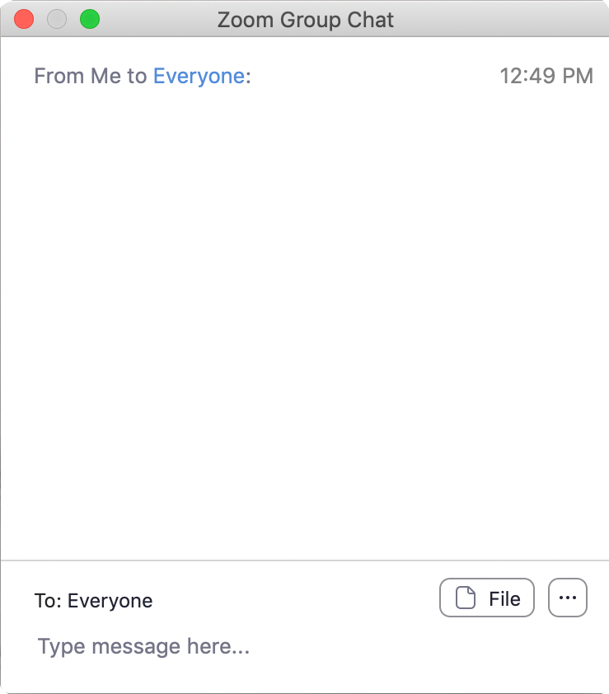
We Encourage Patients to Submit Questions
Feel free to submit questions now before the program begins and throughout the program.

Slide 15
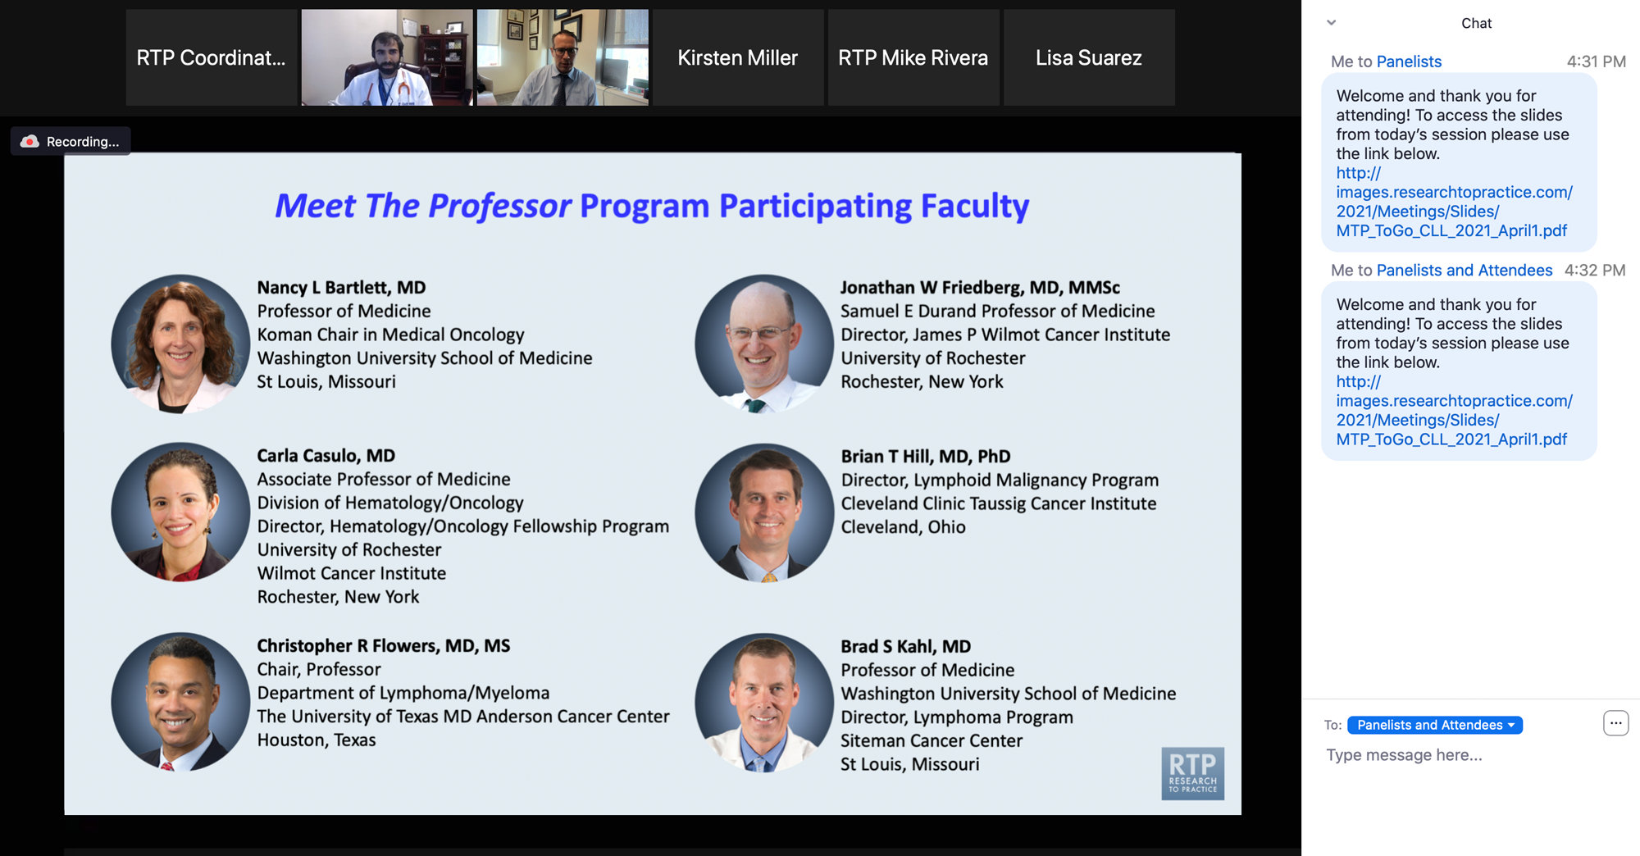
Familiarizing Yourself with the Zoom Interface
Expand chat submission box
Drag the white line above the submission box up to create more space for your message.

Slide 16
Familiarizing Yourself with the Zoom Interface
Increase chat font size
Press Command (for Mac) or Control (for PC) and the + symbol. You may do this as many times as you need for readability.

Slide 17
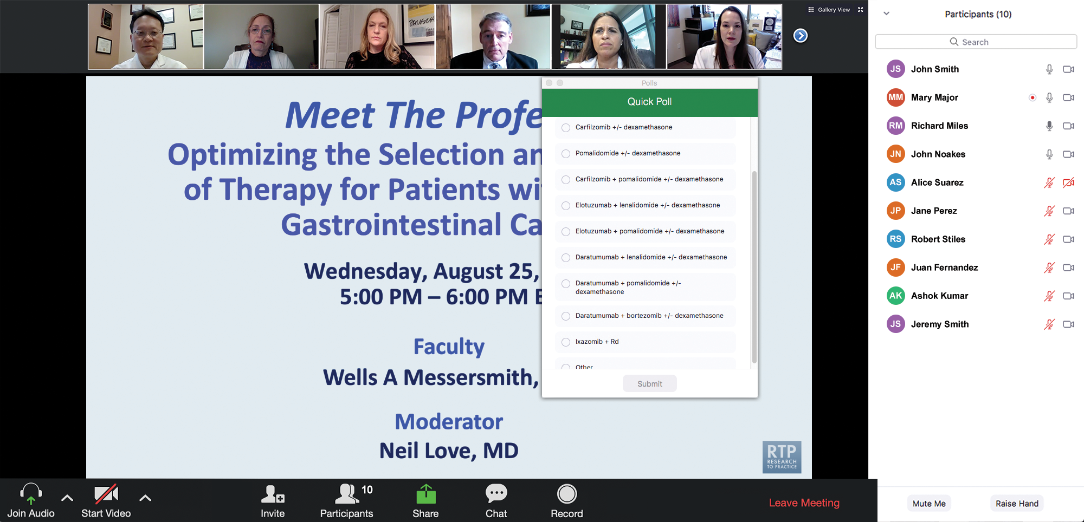
Patients in the Audience, Please Complete the Pre- and Postmeeting Surveys
Quick Survey
Quick Poll

Slide 18
Cancer Q&A: Addressing Common Questions Posed by Patients with Relapsed/Refractory Multiple Myeloma
A Live Webinar for Patients, Developed in Partnership with CancerCare®
Wednesday, July 23, 2025 6:00 PM – 7:00 PM ET
Faculty
Natalie S Callander, MD
Sagar Lonial, MD, FACP
Moderator
Neil Love, MD

Slide 19
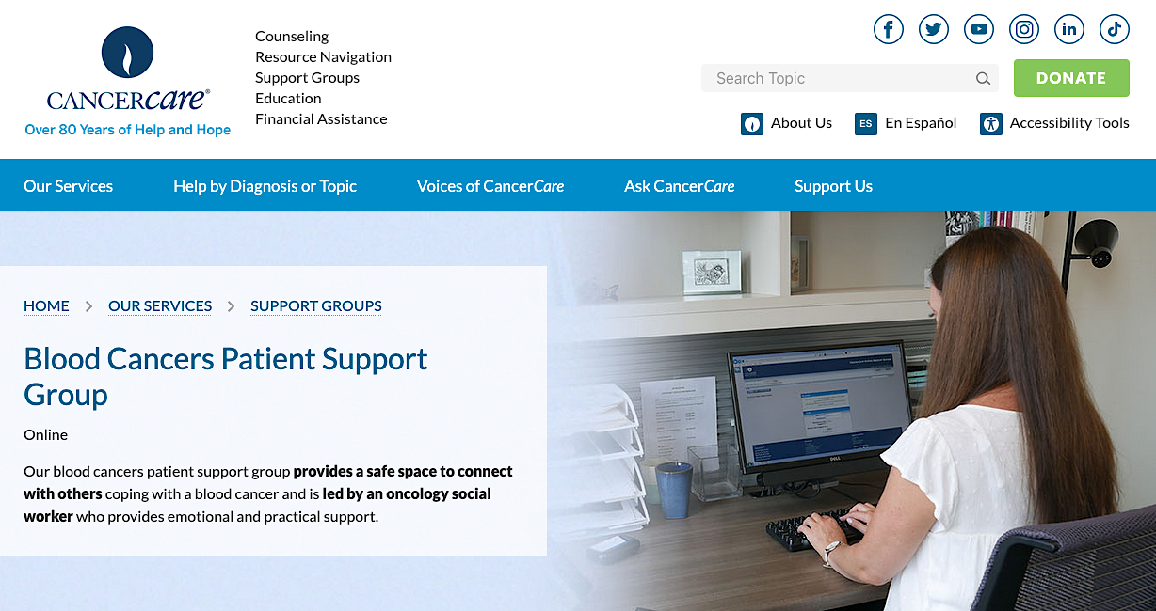

Slide 20
Faculty
Natalie S Callander, MD
Director, Myeloma Clinical Program
University of Wisconsin Carbone Cancer Center
Madison, Wisconsin
MODERATOR
Neil Love, MD Research To Practice Miami, Florida
Sagar Lonial, MD, FACP
Chair and Professor
Department of Hematology and Medical Oncology
Chief Medical Officer
Winship Cancer Institute
Emory University School of Medicine
Atlanta, Georgia

Slide 21
Survey Participants
Rafael Fonseca, MD
Chief Innovation Officer
Getz Family Professor of Cancer
Distinguished Mayo Investigator
Mayo Clinic in Arizona
Phoenix, Arizona
Noopur Raje, MD
Director, Center for Multiple Myeloma
Rita Kelley Chair in Oncology
Massachusetts General Hospital Cancer Center
Professor of Medicine
Harvard Medical School
Boston, Massachusetts
Robert Z Orlowski, MD, PhD
Florence Maude Thomas Cancer Research Professor
Department of Lymphoma and Myeloma
Professor, Department of Experimental Therapeutics
Vice Chair, Myeloma Translational Research
Division of Cancer Medicine
The University of Texas MD Anderson Cancer Center
Houston, Texas
Paul G Richardson, MD
Clinical Program Leader and Director of Clinical Research
Jerome Lipper Multiple Myeloma Center
Dana-Farber Cancer Institute
RJ Corman Professor of Medicine
Harvard Medical School
Boston, Massachusetts

Slide 22
We Encourage Patients to Submit Questions
Feel free to submit questions now before the program begins and throughout the program.

Slide 23
Patients in the Audience, Please Complete the Pre- and Postmeeting Surveys
Quick Survey
Quick Poll

Slide 24
Cancer Q&A: Addressing Common Questions Posed by Patients with Relapsed/Refractory Multiple Myeloma
A Live Webinar for Patients, Developed in Partnership with CancerCare®
Wednesday, July 23, 2025 6:00 PM – 7:00 PM ET
Faculty
Natalie S Callander, MD
Sagar Lonial, MD, FACP
Moderator
Neil Love, MD

Slide 25
Dr Callander — Disclosures Faculty
No relevant conflicts of interest to disclose.

Slide 26
Dr Lonial — Disclosures Faculty
Advisory Committees and Consulting Agreements | AbbVie Inc, Amgen Inc, Bristol Myers Squibb, Genentech, a member of the Roche Group, GSK, Janssen Biotech Inc, Novartis, Pfizer Inc, Regeneron Pharmaceuticals Inc, Takeda Pharmaceuticals USA Inc
Boards of Directors | TG Therapeutics Inc
Contracted Research | Bristol Myers Squibb, Janssen Biotech Inc, Novartis, Takeda Pharmaceuticals USA Inc
Stock Options/Stock — Public Companies | TG Therapeutics Inc

Slide 27
Dr Fonseca — Disclosures Survey Participant
Boards of Directors | Antengene
Consulting Agreements | AbbVie Inc, Adaptive Biotechnologies Corporation, Amgen Inc, Apple, Bristol Myers Squibb, Celgene Corporation, GSK, Janssen Biotech Inc, Karyopharm Therapeutics, Pfizer Inc, RA Capital Management, Regeneron Pharmaceuticals Inc, Sanofi
Data and Safety Monitoring Boards/Committees | Bristol Myers Squibb
Patents (Through Institution) | Abbott
Scientific Advisory Boards | Caris Life Sciences
Stock Options/Stock — Public Companies | Antengene, Caris Life Sciences

Slide 28
Dr Orlowski — Disclosures Survey Participant
Advisory Committees and Consulting Agreements | AbbVie Inc, Adaptive Biotechnologies Corporation, Asylia Therapeutics Inc, Biotheryx, Bristol Myers Squibb, CellCentric, DEM BioPharma, IASO Bio, Karyopharm Therapeutics, Lytica Therapeutics, Meridian Therapeutics, Monte Rosa Therapeutics, MYELOMA360, Neoleukin Therapeutics Inc, Oncopeptides, Pfizer Inc, Regeneron Pharmaceuticals Inc, Sanofi, Takeda Pharmaceuticals USA Inc
Stock Options — Private Companies | Asylia Therapeutics Inc

Slide 29
Dr Raje — Disclosures Survey Participant
Advisory Committees | Advisor to AstraZeneca Pharmaceuticals LP, Bristol Myers Squibb, Genentech, a member of the Roche Group, GSK, Johnson & Johnson, Pfizer Inc, Sanofi

Slide 30
Dr Richardson — Disclosures Survey Participant
Consulting Agreements | Bristol Myers Squibb, Celgene Corporation, GSK, Karyopharm Therapeutics, Oncopeptides, Regeneron Pharmaceuticals Inc, Sanofi
Contracted Research | Oncopeptides

Slide 31
Dr Love — Disclosures
Dr Love is president and CEO of Research To Practice. Research To Practice receives funds in the form of educational grants to develop CME activities from the following companies: Aadi Bioscience, AbbVie Inc, ADC Therapeutics, Alexion Pharmaceuticals, Amgen Inc, Array BioPharma Inc, a subsidiary of Pfizer Inc, Arvinas, Astellas, AstraZeneca Pharmaceuticals LP, Aveo Pharmaceuticals, Bayer HealthCare Pharmaceuticals, BeOne, Black Diamond Therapeutics Inc, Blueprint Medicines, Boehringer Ingelheim Pharmaceuticals Inc, Bristol Myers Squibb, Clovis Oncology, Coherus BioSciences, CTI BioPharma, a Sobi Company, Daiichi Sankyo Inc, Eisai Inc, Elevation Oncology Inc, Exact Sciences Corporation, Exelixis Inc, Genentech, a member of the Roche Group, Genmab US Inc, Geron Corporation, Gilead Sciences Inc, GSK, Hologic Inc, ImmunoGen Inc, Incyte Corporation, Ipsen Biopharmaceuticals Inc, Jazz Pharmaceuticals Inc, Johnson & Johnson, Karyopharm Therapeutics, Kite, A Gilead Company, Kura Oncology, Legend Biotech, Lilly, MEI Pharma Inc, Merck, Mersana Therapeutics Inc, Mirati Therapeutics Inc, Mural Oncology Inc, Natera Inc, Novartis, Novartis Pharmaceuticals Corporation on behalf of Advanced Accelerator Applications, Novocure Inc, Nuvalent, Pfizer Inc, Pharmacyclics LLC, an AbbVie Company, Puma Biotechnology Inc, Regeneron Pharmaceuticals Inc, Rigel Pharmaceuticals Inc, R-Pharm US, Sanofi, Seagen Inc, Servier Pharmaceuticals LLC, SpringWorks Therapeutics Inc, Stemline Therapeutics Inc, Syndax Pharmaceuticals, Taiho Oncology Inc, Takeda Pharmaceuticals USA Inc, TerSera Therapeutics LLC, and Tesaro, A GSK Company.

Slide 32
Commercial Support
This activity is supported by an educational grant from GSK.
Research To Practice CME Planning Committee Members, Staff and Reviewers
Planners, scientific staff and independent reviewers for Research To Practice have no relevant conflicts of interest to disclose.

Slide 33
This educational activity contains discussion of non-FDA-approved uses of agents and regimens. Please refer to official prescribing information for each product for approved indications.

Slide 34
Cancer Q&A: Addressing Common Questions Posed by Patients with Relapsed/Refractory Multiple Myeloma
A CME/MOC-Accredited Webinar Developed in Partnership with CancerCare®
Thursday, August 7, 2025 5:00 PM – 6:00 PM ET
Faculty
Natalie S Callander, MD
Sagar Lonial, MD, FACP
Moderator
Neil Love, MD

Slide 35
Oncology Q&A: Addressing Common Questions Posed by Patients with Metastatic Triple-Negative Breast Cancer A Live Webinar for Patients, Developed in Partnership with the Triple Negative Breast Cancer Foundation
Wednesday, November 13, 2024 6:00 PM – 7:00 PM ET
Faculty
Lisa A Carey, MD, ScM, FASCO
Rita Nanda, MD
Moderator
Neil Love, MD

Slide 36
Oncology Q&A: Discussing Common Questions Posed by Patients with Metastatic Triple-Negative Breast Cancer A CME/MOC- and NCPD-Accredited Webinar Developed in Partnership with the Triple Negative Breast Cancer Foundation
Tuesday, January 7, 2025 5:00 PM – 6:00 PM ET
Faculty
Lisa A Carey, MD, ScM, FASCO
Rita Nanda, MD
Moderator
Neil Love, MD

Slide 37
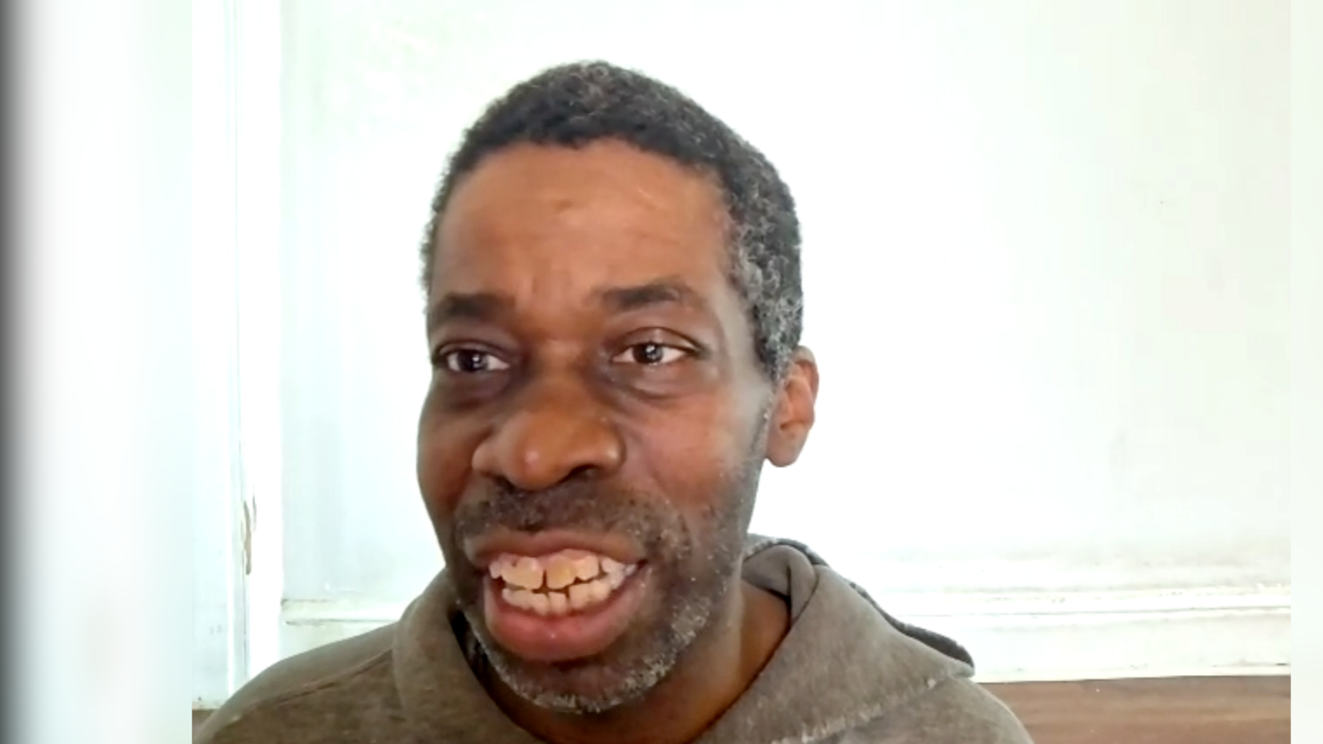
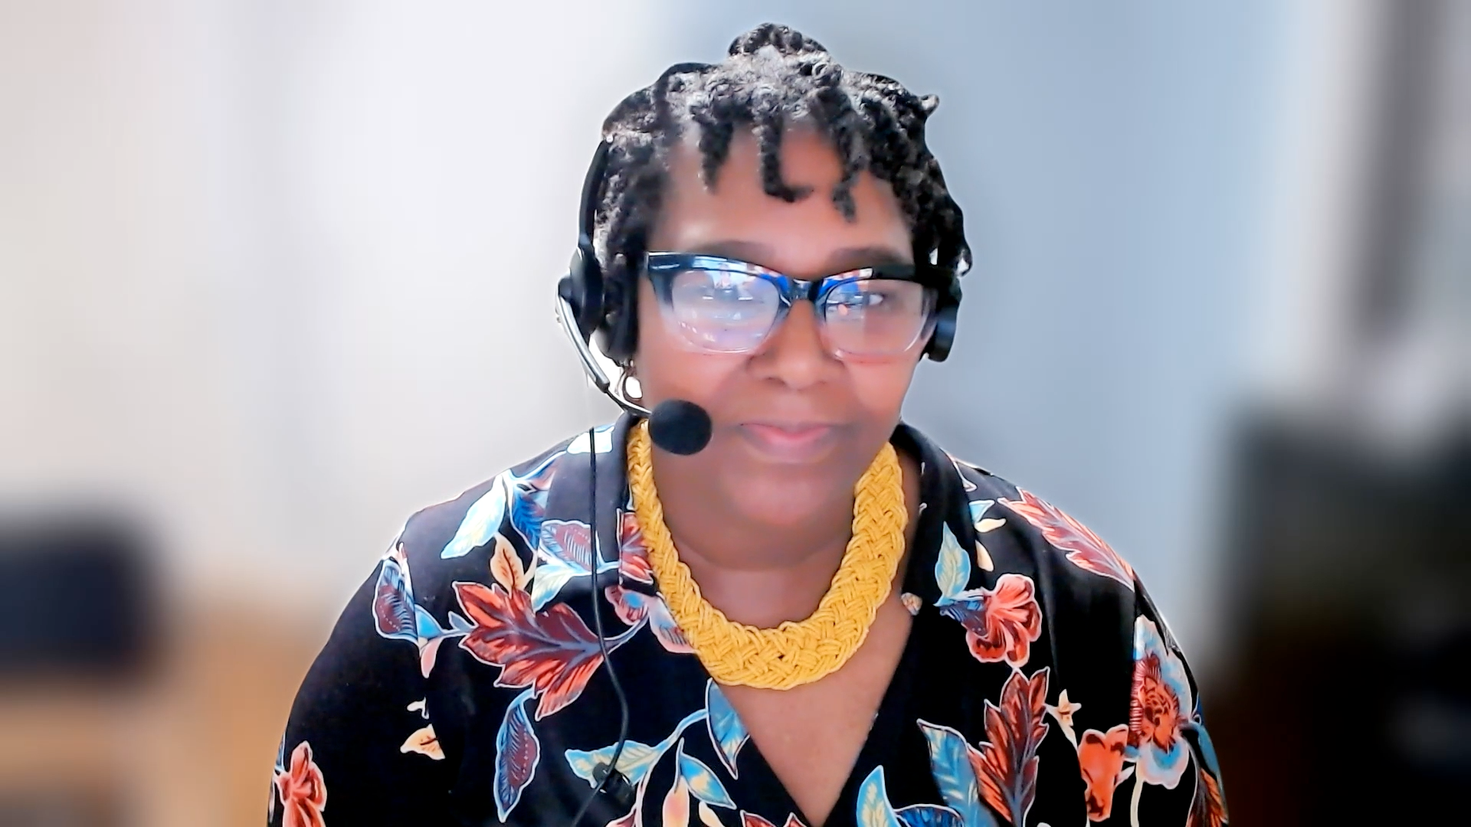
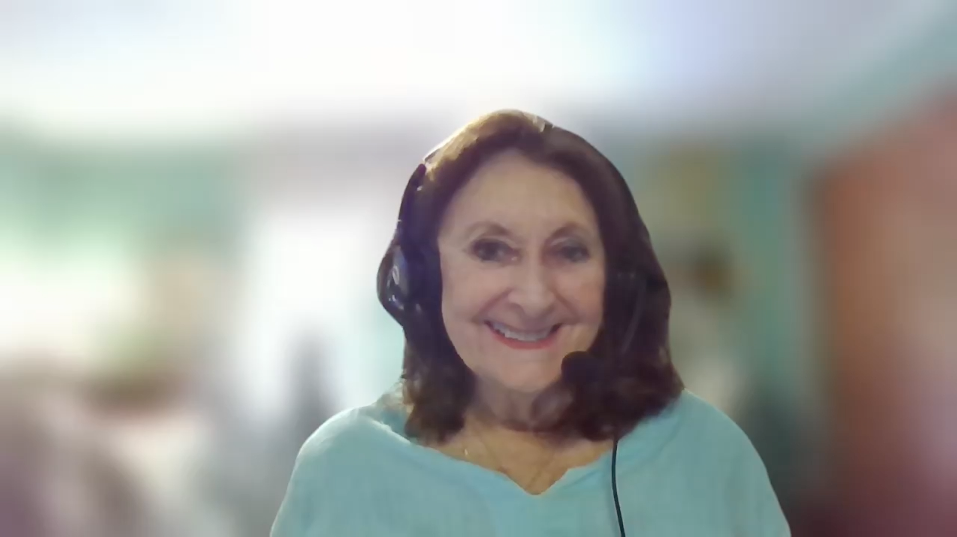
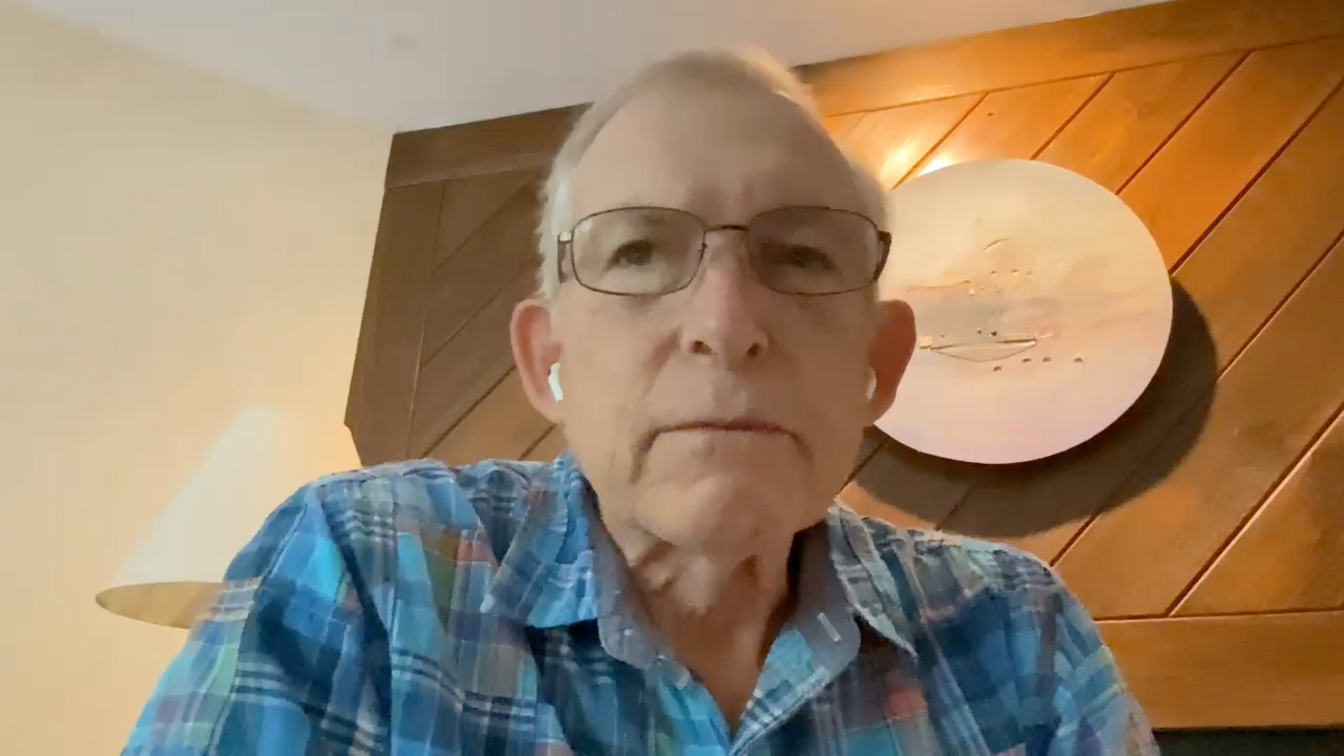
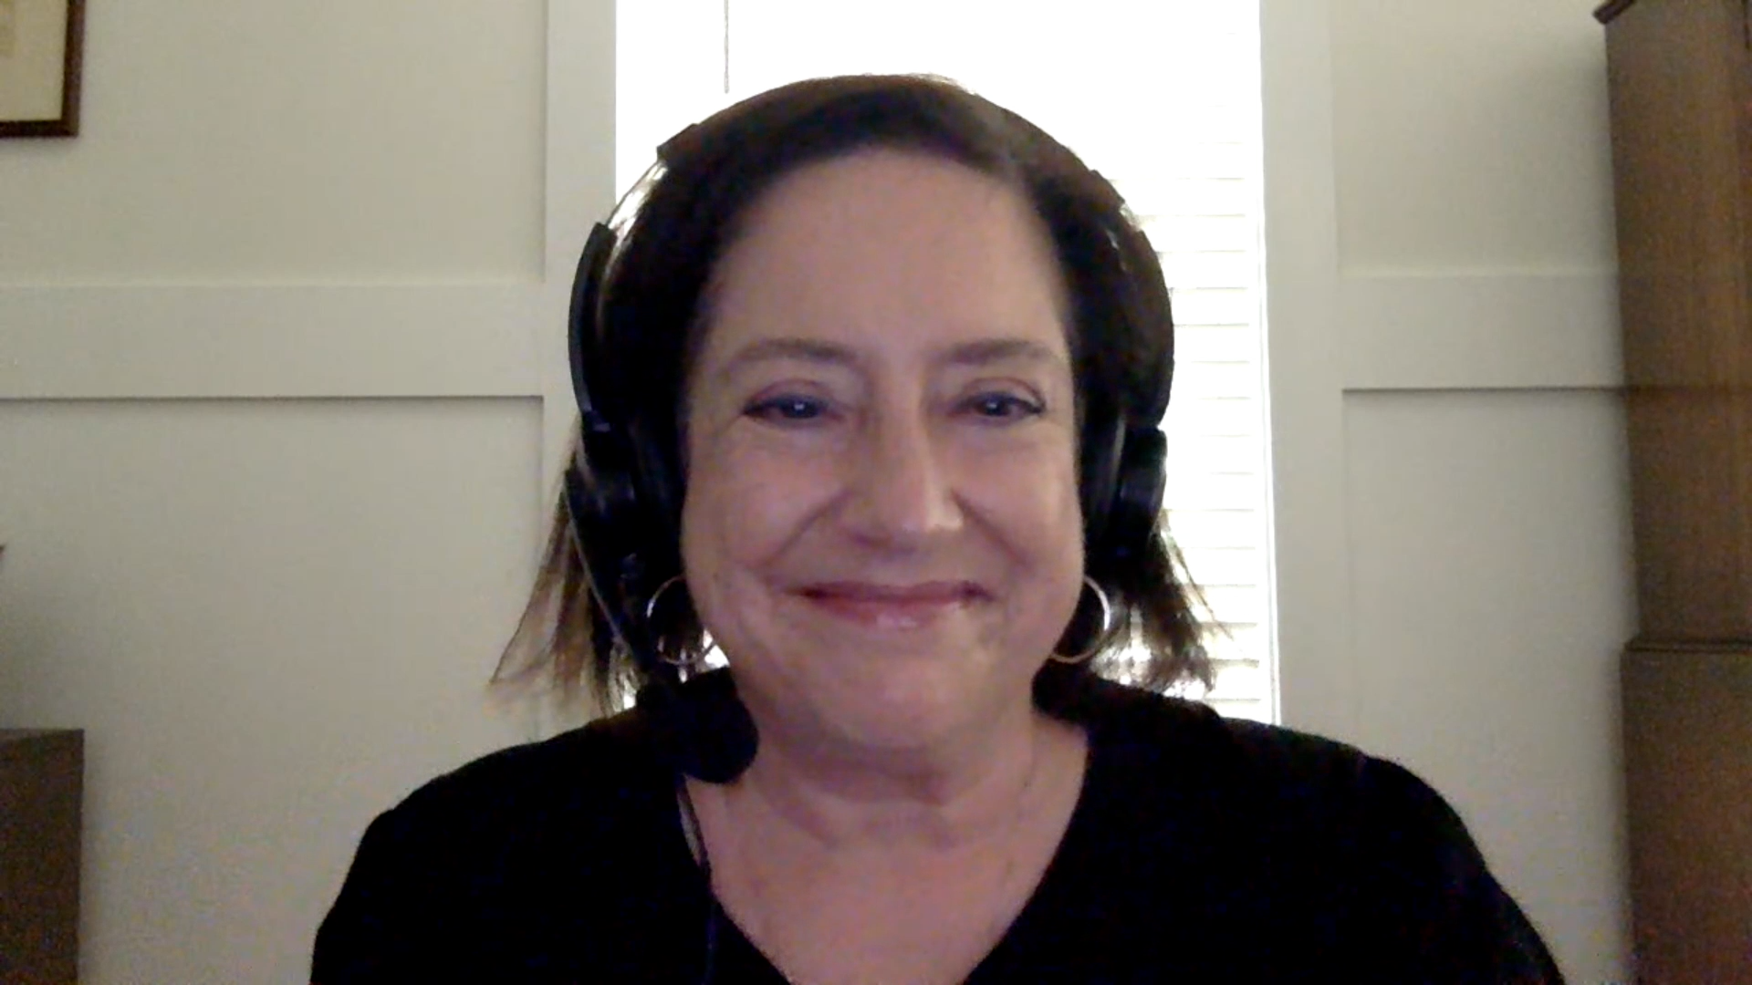
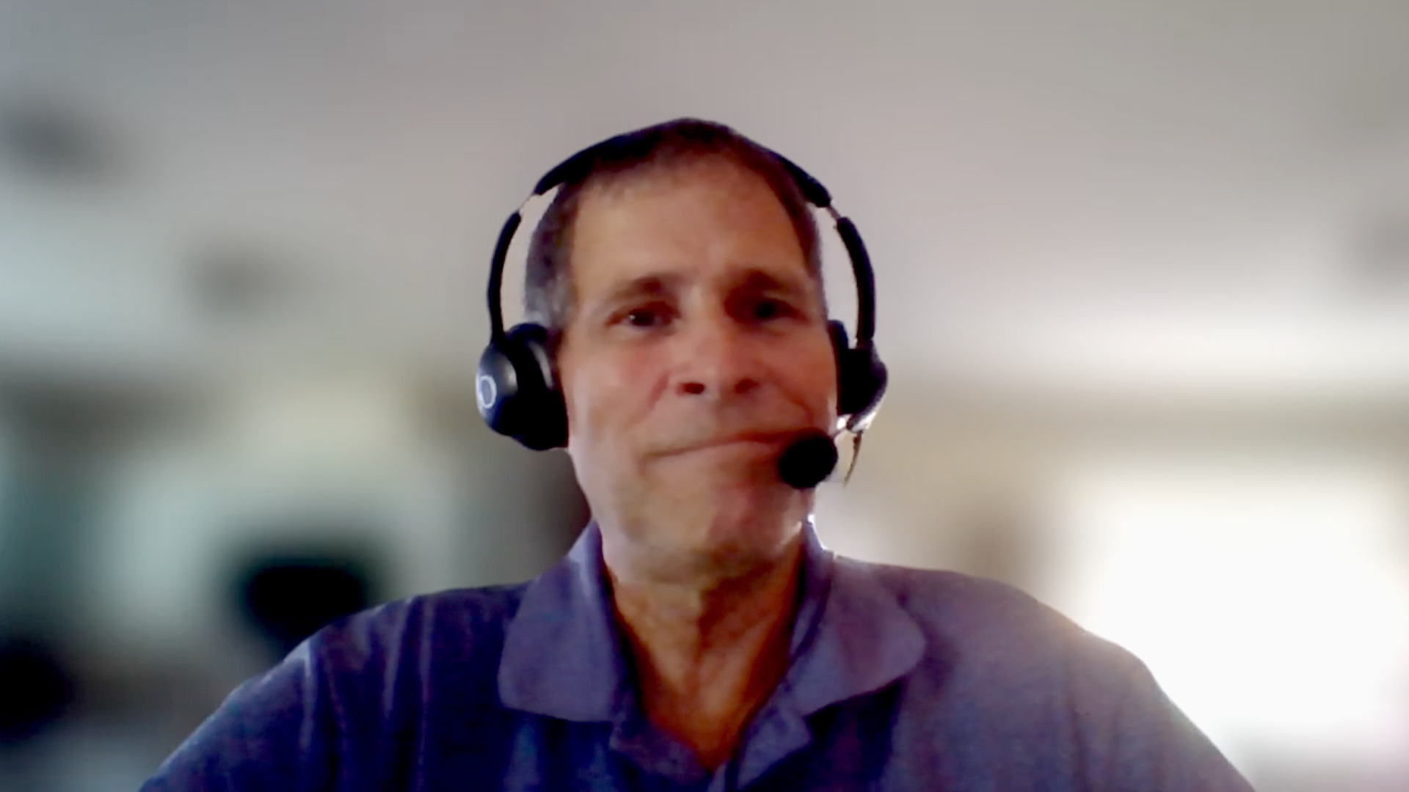
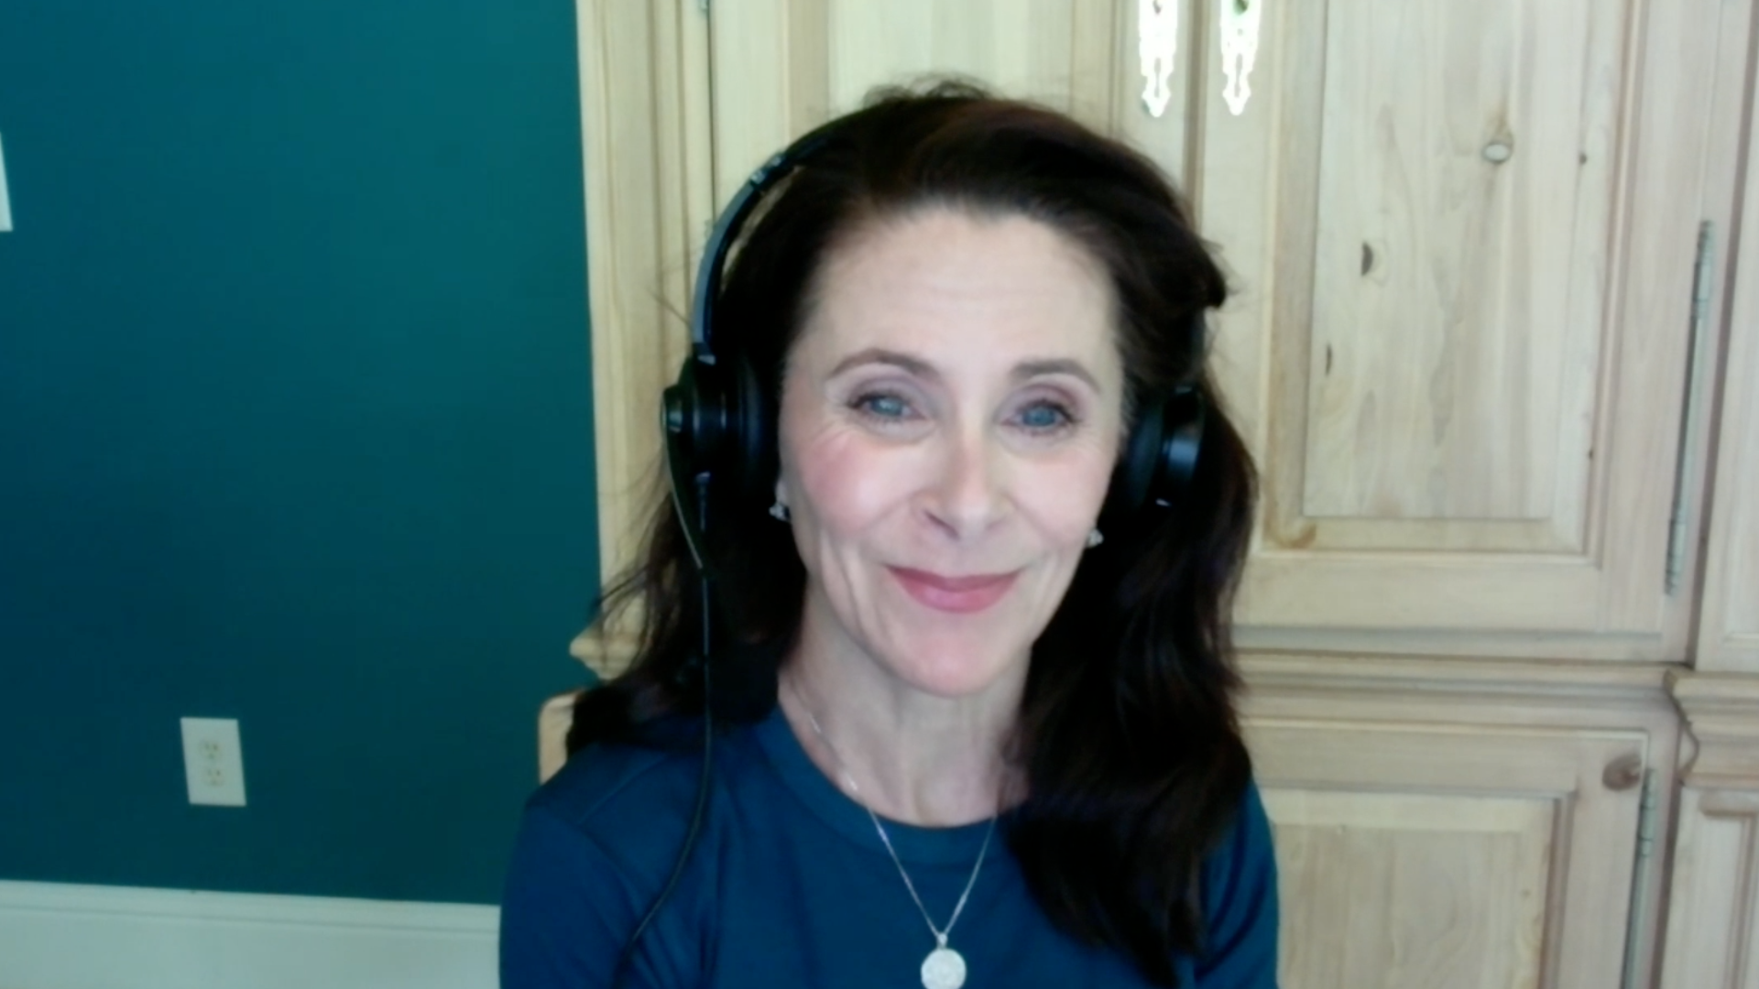
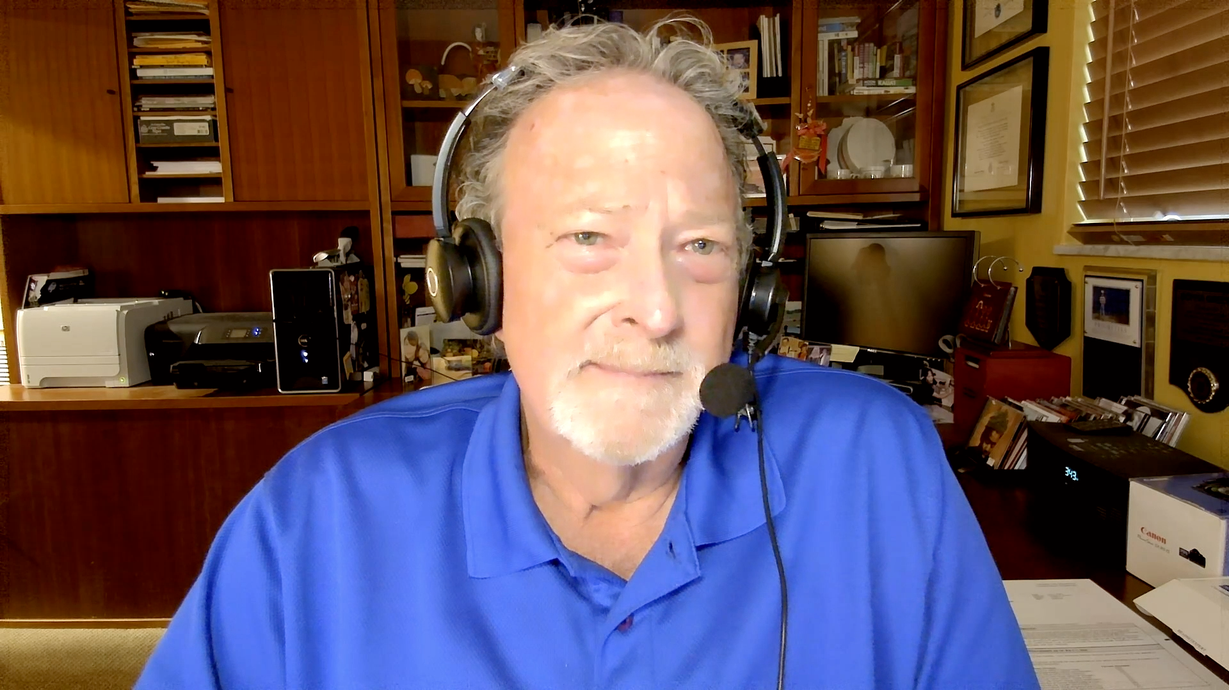
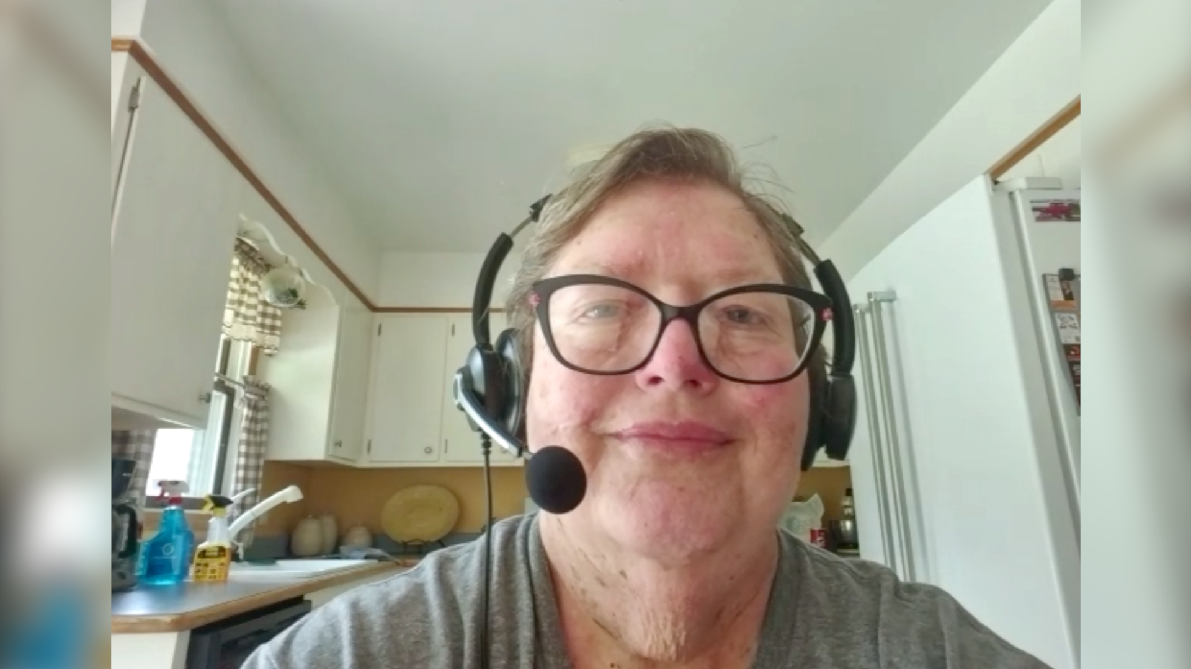

Slide 38
Cancer Q&A Relapsed/Refractory Multiple Myeloma
Introduction: Multiple myeloma — 2005 to 2025
Module 1: Questions from the beginning
Module 2: Choosing options
Module 3: Clinical trials
Module 4: Neuropathy
Module 5: Chimeric antigen receptor (CAR) T-cell therapy
Module 6: Bispecific antibodies
Module 7: Antibody-drug conjugates
Module 8: Interacting with the oncology team
Module 9: Other questions

Slide 39
Cancer Q&A Relapsed/Refractory Multiple Myeloma
Introduction: Multiple myeloma — 2005 to 2025
Module 1: Questions from the beginning
Module 2: Choosing options
Module 3: Clinical trials
Module 4: Neuropathy
Module 5: Chimeric antigen receptor (CAR) T-cell therapy
Module 6: Bispecific antibodies
Module 7: Antibody-drug conjugates
Module 8: Interacting with the oncology team
Module 9: Other questions

Slide 40
Cancer Q&A Relapsed/Refractory Multiple Myeloma
Introduction: Multiple myeloma — 2005 to 2025
Module 1: Questions from the beginning
Module 2: Choosing options
Module 3: Clinical trials
Module 4: Neuropathy
Module 5: Chimeric antigen receptor (CAR) T-cell therapy
Module 6: Bispecific antibodies
Module 7: Antibody-drug conjugates
Module 8: Interacting with the oncology team
Module 9: Other questions

Slide 41
Questions from the beginning

Slide 42
For a patient with newly diagnosed standard-risk multiple myeloma (MM), what are the chances of cure?
We still cannot cure MM for most patients, but we hope to be able to keep your myeloma controlled for many years
15%-20% can experience functional cure
We have much better treatments so that patients can now live many years, and we are likely curing about 20%-30% of patients with today’s best options
About 10% of standard-risk patients will not experience relapse from their first line of therapy and could thus be considered cured
Chance of cure for standard-risk MM is 50% to 60%
Estimated overall survival is now 10-15 years, but MM remains incurable in the longer term

Slide 43
For a patient who is receiving first-line treatment for standard-risk MM, on average how long will it be before a different therapy is needed?
Today’s therapies offer good control for many years, often 10 or more, before a treatment may have to be changed
Median time for patients receiving D-RVd induction and transplant is >10 years
Greater than 5 years should be expected
For a standard-risk patient, PFS is about 7 years so treatment with a second therapy will be needed in 7-8 years
Close to 10 years
If quadruplet therapy is used as initial therapy, then a median of 7-8 years of PFS is expected
D-RVd = daratumumab with lenalidomide/bortezomib/dexamethasone; PFS = disease progression-free survival

Slide 44
Will I likely require continuous treatment for MM?
This will depend on whether your MM is more aggressive or not
For now, yes
It is likely that after some time, 3 to 4 years, you will be completely off therapy
Continuous treatment is part of the standard for initial therapy, but emerging data suggest a low relapse risk for patients who achieve and maintain MRD negativity 3-5 years
Using MRD-adapted therapy, we should be able to discontinue therapy. High-risk disease will likely require more continuous therapy
Yes
MRD = minimal residual disease

Slide 45
Cancer Q&A Relapsed/Refractory Multiple Myeloma
Introduction: Multiple myeloma — 2005 to 2025
Module 1: Questions from the beginning
Module 2: Choosing options
Module 3: Clinical trials
Module 4: Neuropathy
Module 5: Chimeric antigen receptor (CAR) T-cell therapy
Module 6: Bispecific antibodies
Module 7: Antibody-drug conjugates
Module 8: Interacting with the oncology team
Module 9: Other questions

Slide 46
Choosing options

Slide 47
Cancer Q&A Relapsed/Refractory Multiple Myeloma
Introduction: Multiple myeloma — 2005 to 2025
Module 1: Questions from the beginning
Module 2: Choosing options
Module 3: Clinical trials
Module 4: Neuropathy
Module 5: Chimeric antigen receptor (CAR) T-cell therapy
Module 6: Bispecific antibodies
Module 7: Antibody-drug conjugates
Module 8: Interacting with the oncology team
Module 9: Other questions

Slide 48
Clinical trials

Slide 49
How likely is it that I will be able to participate in a clinical trial with a reasonable probability of benefitting?
We will look for a clinical trial for you at every step, whether you have smoldering myeloma or have experienced relapse many times. We try to maintain a portfolio of many trials
80% or higher
Most patients on trials benefit, and have a greater degree of scrutiny of their case
It is likely that you will be eligible for a clinical trial at least once during your myeloma journey. The probability of benefitting will depend on several factors
Very likely
Very high likelihood

Slide 50
What are some new therapies on the horizon that you consider to be promising for patients with R/R MM?
Mezigdomide (CELMoD), trispecific antibodies, anitocabtagene autoleucel (anito-cel)
CELMoDs, p300 inhibitors
We have so many developments including the trispecific antibodies
CELMoDs, trispecific T-cell engagers, CAR T cells targeted against more than one antigen, and combinations of these drug classes with each other and with our current agents
Cevostamab, anitocabtagene autoleucel (anito-cel), arlocabtagene autoleucel (arlo-cel), CELMoDs mezigdomide and iberdomide
CELMoDs
CELMoDs = cereblon E3 ligase modulatory drugs

Slide 51
Cancer Q&A Relapsed/Refractory Multiple Myeloma
Introduction: Multiple myeloma — 2005 to 2025
Module 1: Questions from the beginning
Module 2: Choosing options
Module 3: Clinical trials
Module 4: Neuropathy
Module 5: Chimeric antigen receptor (CAR) T-cell therapy
Module 6: Bispecific antibodies
Module 7: Antibody-drug conjugates
Module 8: Interacting with the oncology team
Module 9: Other questions

Slide 52
Neuropathy

Slide 53
Cancer Q&A Relapsed/Refractory Multiple Myeloma
Introduction: Multiple myeloma — 2005 to 2025
Module 1: Questions from the beginning
Module 2: Choosing options
Module 3: Clinical trials
Module 4: Neuropathy
Module 5: Chimeric antigen receptor (CAR) T-cell therapy
Module 6: Bispecific antibodies
Module 7: Antibody-drug conjugates
Module 8: Interacting with the oncology team
Module 9: Other questions

Slide 54
Chimeric antigen receptor (CAR) T-cell therapy

Slide 55
What is the likelihood that my disease will respond to CAR T-cell therapy? What is the typical duration of response?
Response rates, meaning obtaining a remission, are very high. Some patients may not need any other treatments for several years
90% of patients will respond to CAR T, and the average is 2-3 years of remission
Most patients respond (>90%), and in general we think it can last for about 3 years
Response rates are quite high and better than those seen with most other therapies available to us. The exact response rate and duration of response depends on several factors
Response is 40%-80%, and the duration is 1 year to 3.6 years, depending on the type of CAR T construct used
80% chance of response with a duration of 1 to 2 years

Slide 56
What are the most likely side effects associated with CAR T-cell therapy?
Increased risk of infections; most patients experience fever in the first week after infusion, and rarely more significant side effects called cytokine release syndrome
Infusion-related toxicity (CRS) and risk of longer-term side effects such as immune-related GI side effects and neurologic side effects
The major and most likely toxicities include a heightened risk of infections. There are other serious toxicities, but fortunately they are rare
Common side effects include CRS, ICANS, decreased blood counts and infections
CRS, ICANS, low blood cell counts (cytopenias) and infections
CRS and ICANS
CRS = cytokine release syndrome; GI = gastrointestinal; ICANS = immune effector cell-associated neurotoxicity syndrome

Slide 57
Cancer Q&A Relapsed/Refractory Multiple Myeloma
Introduction: Multiple myeloma — 2005 to 2025
Module 1: Questions from the beginning
Module 2: Choosing options
Module 3: Clinical trials
Module 4: Neuropathy
Module 5: Chimeric antigen receptor (CAR) T-cell therapy
Module 6: Bispecific antibodies
Module 7: Antibody-drug conjugates
Module 8: Interacting with the oncology team
Module 9: Other questions

Slide 58
Bispecific antibodies

Slide 59
What is the likelihood that my disease will respond to bispecific antibody therapy? What is the typical duration of response?
About 7/10 pts respond. Those who get a deep response can be in remission for years. On average, the response is about 1 year
70%, the average is 1-2 years
About 2 out of 3 patients will respond, but what matters more is the depth of response — those who respond very well (CR or better) can have results that are as good a CAR Ts
Bispecific antibody response rates run from 60% to 75%, while the duration of response varies from about 12 to 24 months, depending on the bispecific used
Likelihood of response is 60% with 18 to 24 months duration
70% chance of response with a duration of 12 months
CR = complete response

Slide 60
What are the most likely side effects associated with bispecific antibodies?
Bispecifics that target BCMA are associated with a high risk of infection and patients need prophylactic antibiotics and antibodies (IVIG)
Similar to those of CAR T-cell therapy (CRS, neurologic effects, immune-related GI effects) but lower severity
Mainly infections and the need to be very proactive with IgG replacement
CRS, ICANS, decreased blood counts and infections
CRS, ICANS, low blood cell counts (cytopenias) and infections
CRS and infections
IVIG = intravenous immunoglobulin; CRS = cytokine release syndrome; GI = gastrointestinal; IgG = immunoglobulin; ICANS = immune effector cell-associated neurotoxicity syndrome

Slide 61
Cancer Q&A Relapsed/Refractory Multiple Myeloma
Introduction: Multiple myeloma — 2005 to 2025
Module 1: Questions from the beginning
Module 2: Choosing options
Module 3: Clinical trials
Module 4: Neuropathy
Module 5: Chimeric antigen receptor (CAR) T-cell therapy
Module 6: Bispecific antibodies
Module 7: Antibody-drug conjugates
Module 8: Interacting with the oncology team
Module 9: Other questions

Slide 62
Antibody-drug conjugates

Slide 63
What is the likelihood that my disease will respond to belantamab mafodotin? What is the typical duration of response?
If given alone, about 1/3 of patients respond, and they tend to have long response durations, often about 1 year or more. If given in combination, most will have a response that can last several years
In combinations, chances of response are 85% or higher, and the duration is 2-3 years
We can see responses that are very durable, sometimes close to 3 years
The response rate for belantamab combined with bortezomib/dex was about 83%, while the average combined with pomalidomide/dex was 77%
Likelihood of response is 30%, and response duration is 9 to 12 months
In combination, the chance of response is 70%-80%, and the median PFS is 3 years
dex = dexamethasone; PFS = disease progression-free survival

Slide 64
What are the ocular side effects associated with belantamab mafodotin? What signs or symptoms of ocular toxicity do I need to be aware of? Are the ocular side effects associated with belantamab mafodotin reversible?
If belantamab is given in short intervals (eg, 3 weeks) dry eye is common, as well as blurry vision and rarely pain and inflammation
Impact on vision, changes in visual acuity, ability to read or drive, dry eyes, itchy eyes; these effects are reversible
Symptoms range from scratchy eyes to blurred vision. With newer dosing and schedule approaches we can make the eye toxicities more manageable. They can be very uncomfortable, but know they are always reversible
Dry eyes or excessive tearing, inflammation of the eyelids or cornea with eye pain and reduced sharpness of vision; these effects typically resolve over time
Blurry vision — due to cysts in the conjunctiva; reversible with dose decrease and delays
Keratopathy, which is manageable and reversible

Slide 65
How are the ocular side effects associated with belantamab mafodotin prevented and managed? Will I need to see an optometrist or an ophthalmologist to monitor for ocular toxicities? How often?
Side effects are managed by using a longer interval between doses, lubricating eye drops. Before every dose, we will have you see an ophthalmologist or optometrist familiar with the drug
Holding or reducing the dose or spreading out the dose to reduce future risk; monitoring by eye care professional is done once every 3-4 weeks depending on severity
We will engage with the ophthalmology team, usually once a month, and monitor. We are able to manage these better now
We currently do not have good prevention strategies for the ocular side effects. You would typically see an optometrist or ophthalmologist before starting belantamab and then before each next dose
Side effects may be managed by decreasing belantamab dose and decreasing dose intensity
Side effects are manageable utilizing KVA monitoring, eye drops, dose reduction and schedule change; initially will need to consult eye specialist monthly x 4, then as needed

Slide 66
Cancer Q&A Relapsed/Refractory Multiple Myeloma
Introduction: Multiple myeloma — 2005 to 2025
Module 1: Questions from the beginning
Module 2: Choosing options
Module 3: Clinical trials
Module 4: Neuropathy
Module 5: Chimeric antigen receptor (CAR) T-cell therapy
Module 6: Bispecific antibodies
Module 7: Antibody-drug conjugates
Module 8: Interacting with the oncology team
Module 9: Other questions

Slide 67
Interacting with the oncology team

Slide 68
What do you recommend to your patients with R/R MM in terms of exercise, diet and nutrition and complementary treatments like acupuncture and meditation?
I always advocate for exercise, even chair exercises may be helpful. I ask patients to be skeptical of supplements; acupuncture often not covered by insurance
Balanced diet, limited use of supplements, keep as fit as they are able
Just follow your normal life
For patients with lytic/erosive bony lesions, I recommend exercise after evaluation by orthopedics/physical therapy; I obtain a consult with a nutritionist and refer patients to our Integrative Medicine team
Healthy diet with adequate hydration, daily exercise
A comprehensive and proactive approach with exercise, diet/nutrition and certain complementary therapies

Slide 69
At what point do you introduce discussion about palliative care with your patients with R/R MM? Do you discuss advanced directives and other issues related to end-of-life preparation?
Yes, particularly before high-dose therapy, when we encourage patients to have an advanced directive
When symptoms are challenging to manage, or patients have exhausted many treatment options
It is hard as patients have so many options. It is not unusual for MM patients to only have a few days or weeks when they enroll in hospice. I use palliative care support for symptom control as needed
I start mentioning palliative care as an option at the first sign of refractory disease; our institutional policy is to discuss advanced directives no later than the third visit of the patient in our system
Usually when performance status decreases and treatment options are narrowing
Later in the disease course, typically after 3 to 4 lines of therapy

Slide 70
Cancer Q&A Relapsed/Refractory Multiple Myeloma
Introduction: Multiple myeloma — 2005 to 2025
Module 1: Questions from the beginning
Module 2: Choosing options
Module 3: Clinical trials
Module 4: Neuropathy
Module 5: Chimeric antigen receptor (CAR) T-cell therapy
Module 6: Bispecific antibodies
Module 7: Antibody-drug conjugates
Module 8: Interacting with the oncology team
Module 9: Other questions

Slide 71
Other questions

Slide 72
Thank you

Slide 73
Thank you for joining us! Please take a moment to complete the survey currently up on Zoom. Your feedback is very important to us. The survey will remain open for 5 minutes after the meeting ends.

