Slide 1
Cancer Conference Update: ESMO Congress 2025 —
Urothelial Bladder Cancer and Prostate Cancer
A CME/MOC-Accredited Live Webinar
Thursday, November 20, 2025​
5:00 PM – 6:00 PM ET
Faculty
Terence Friedlander, MD
Rana R McKay, MD
Moderator
Neil Love, MD

Slide 2


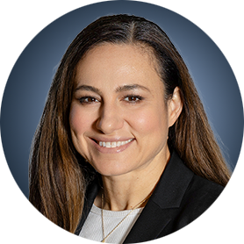
Faculty
Terence Friedlander, MD
Professor of Medicine and Robert and Virginia O’Reilly Family Endowed Chair
Chief, Division of Hematology/Oncology
Zuckerberg San Francisco General Hospital
Helen Diller Family Comprehensive Cancer Center
University of California, San Francisco
San Francisco, California
MODERATOR
Neil Love, MD
Research To Practice
Miami, Florida
Rana R McKay, MD
Professor of Medicine and Urology
Associate Director, Clinical Research
Co-Lead, Genitourinary Program
Moores Cancer Center
University of California San Diego
San Diego, California

Slide 3
Commercial Support
This activity is supported by educational grants from AstraZeneca Pharmaceuticals LP and Natera Inc.

Slide 4
Dr Love — Disclosures
Dr Love is president and CEO of Research To Practice. Research To Practice receives funds in the form of educational grants to develop CME activities from the following companies: Aadi Bioscience, AbbVie Inc, ADC Therapeutics, Agendia Inc, Alexion Pharmaceuticals, Amgen Inc, Array BioPharma Inc, a subsidiary of Pfizer Inc, Arvinas, Astellas, AstraZeneca Pharmaceuticals LP, Aveo Pharmaceuticals, Bayer HealthCare Pharmaceuticals, BeOne, Black Diamond Therapeutics Inc, Blueprint Medicines, Boehringer Ingelheim Pharmaceuticals Inc, Bristol Myers Squibb, Celcuity, Clovis Oncology, Coherus BioSciences, Corcept Therapeutics Inc, CTI BioPharma, a Sobi Company, Daiichi Sankyo Inc, Eisai Inc, Elevation Oncology Inc, Exact Sciences Corporation, Exelixis Inc, Genentech, a member of the Roche Group, Genmab US Inc, Geron Corporation, Gilead Sciences Inc, GSK, Helsinn Therapeutics (US) Inc, Hologic Inc, ImmunoGen Inc, Incyte Corporation, Ipsen Biopharmaceuticals Inc, Jazz Pharmaceuticals Inc, Johnson & Johnson, Karyopharm Therapeutics, Kite, A Gilead Company, Kura Oncology, Legend Biotech, Lilly, MEI Pharma Inc, Merck, Mersana Therapeutics Inc, Mirati Therapeutics Inc, Mural Oncology Inc, Natera Inc, Novartis, Novartis Pharmaceuticals Corporation on behalf of Advanced Accelerator Applications, Novocure Inc, Nuvalent, Pfizer Inc, Pharmacyclics LLC, an AbbVie Company, Puma Biotechnology Inc, Regeneron Pharmaceuticals Inc, Rigel Pharmaceuticals Inc, R-Pharm US, Sanofi, Seagen Inc, Servier Pharmaceuticals LLC, SpringWorks Therapeutics Inc, Stemline Therapeutics Inc, Sumitomo Pharma America, Syndax Pharmaceuticals, Taiho Oncology Inc, Takeda Pharmaceuticals USA Inc, TerSera Therapeutics LLC, and Tesaro, A GSK Company.

Slide 5
Research To Practice CME Planning Committee Members,
Staff and Reviewers
Planners, scientific staff and independent reviewers for Research To Practice have no relevant conflicts of interest to disclose.

Slide 6
Dr Friedlander — Disclosures
Advisory Committees | Aadi Bioscience, AbbVie Inc, Adaptimmune, Astellas, Aktis Oncology, Bicycle Therapeutics, Bristol Myers Squibb, Gilead Sciences Inc, Merck, Pfizer Inc, Samsung Bioepis
Consulting Agreements | Astellas, EMD Serono Inc, Genentech, a member of the Roche Group
Contracted Research | AbbVie Inc, Bicycle Therapeutics, Flare Therapeutics, Genentech, a member of the Roche Group, Johnson & Johnson, Pfizer Inc

Slide 7
Dr McKay — Disclosures
Advisor/Consultant | Ambrx, Arcus Biosciences, AstraZeneca Pharmaceuticals LP, Aveo Pharmaceuticals, Bayer HealthCare Pharmaceuticals, Blue Earth Diagnostics, Bristol Myers Squibb, Calithera Biosciences, Caris Life Sciences, Daiichi Sankyo Inc, Dendreon Pharmaceuticals Inc, Exelixis Inc, Johnson & Johnson, Lilly, Merck, Myovant Sciences, Neomorph, Novartis, Pfizer Inc, Sanofi, Seagen Inc, Sorrento Therapeutics, Telix Pharmaceuticals Limited, Tempus
Institutional Research Funding | Artera, AstraZeneca Pharmaceuticals LP, Bayer HealthCare Pharmaceuticals, Bristol Myers Squibb, Exelixis Inc, Oncternal Therapeutics, Tempus

Slide 8
This educational activity contains discussion of
non-FDA-approved uses of agents and regimens. Please refer to official prescribing information for each product for approved indications.

Slide 9
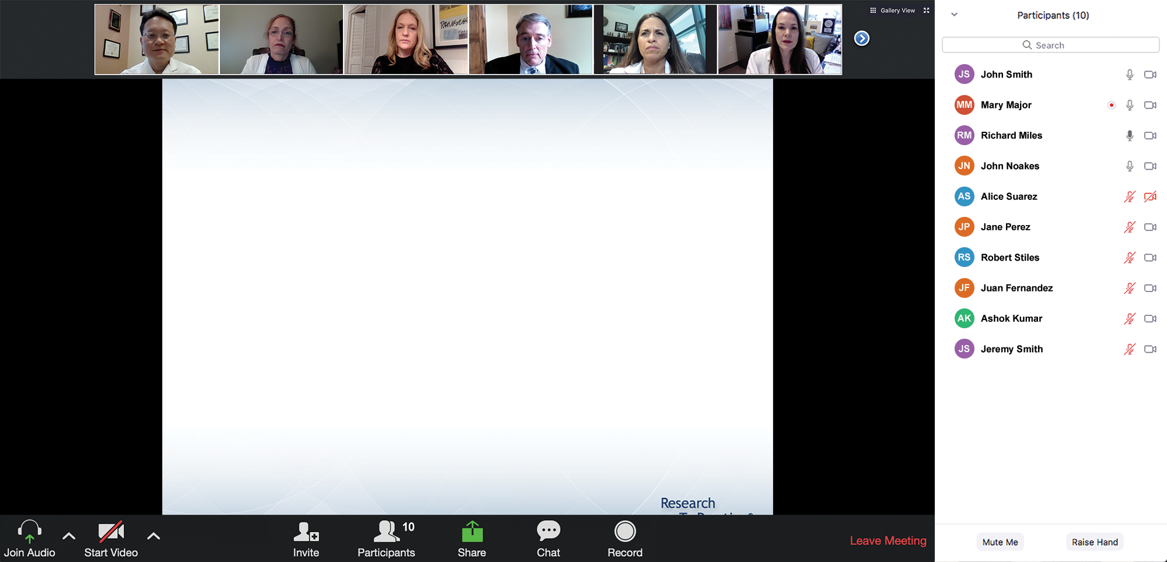

We Encourage Clinicians in Practice to Submit Questions
Feel free to submit questions now before the program begins and throughout the program.

Slide 10
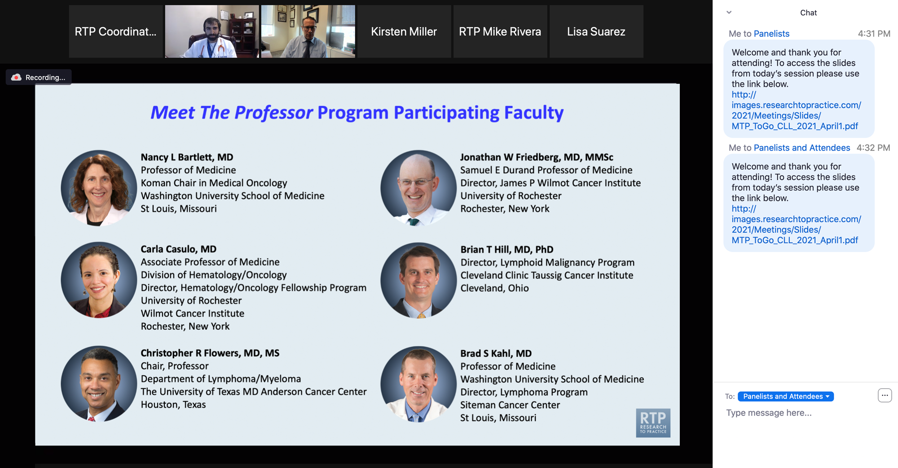
Familiarizing Yourself with the Zoom Interface
Expand chat submission box
Drag the white line above the submission box up to create
more space for your message.

Slide 11
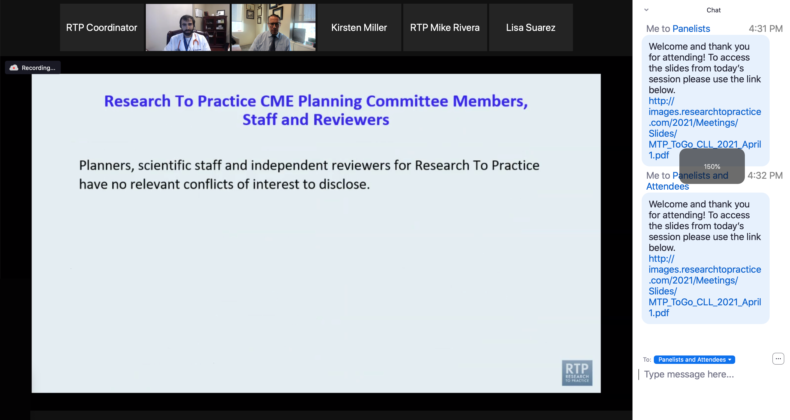
Familiarizing Yourself with the Zoom Interface
Increase chat font size
Press Command (for Mac) or Control (for PC) and the + symbol.
You may do this as many times as you need for readability.

Slide 12
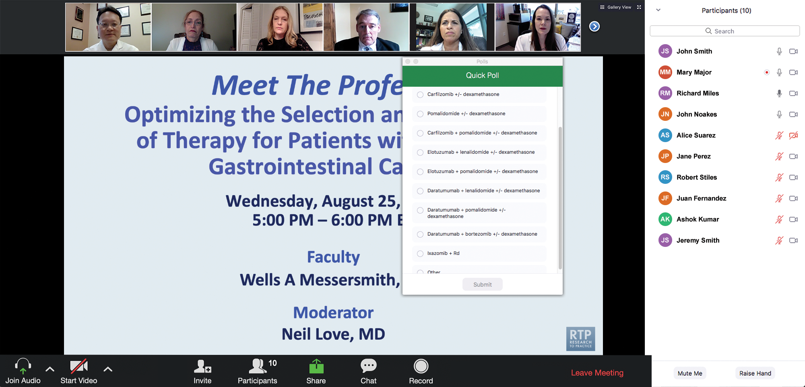
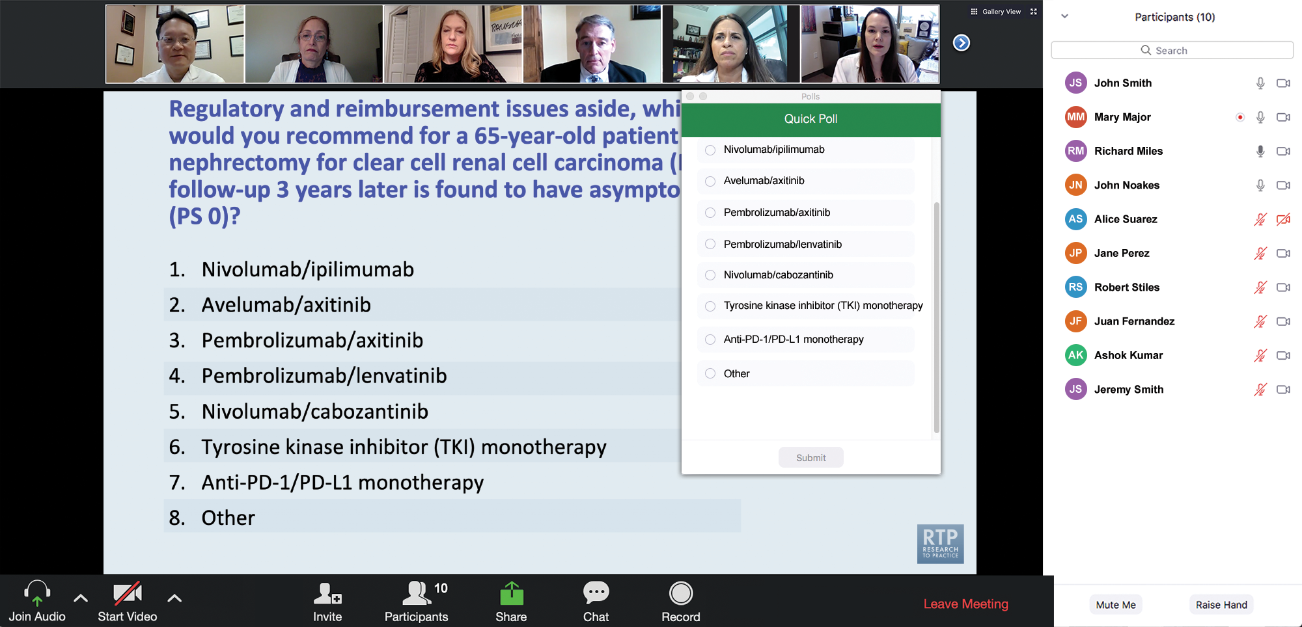
Clinicians in the Audience, Please Complete the Pre- and Postmeeting Surveys
Quick Survey
Quick Poll

Slide 13
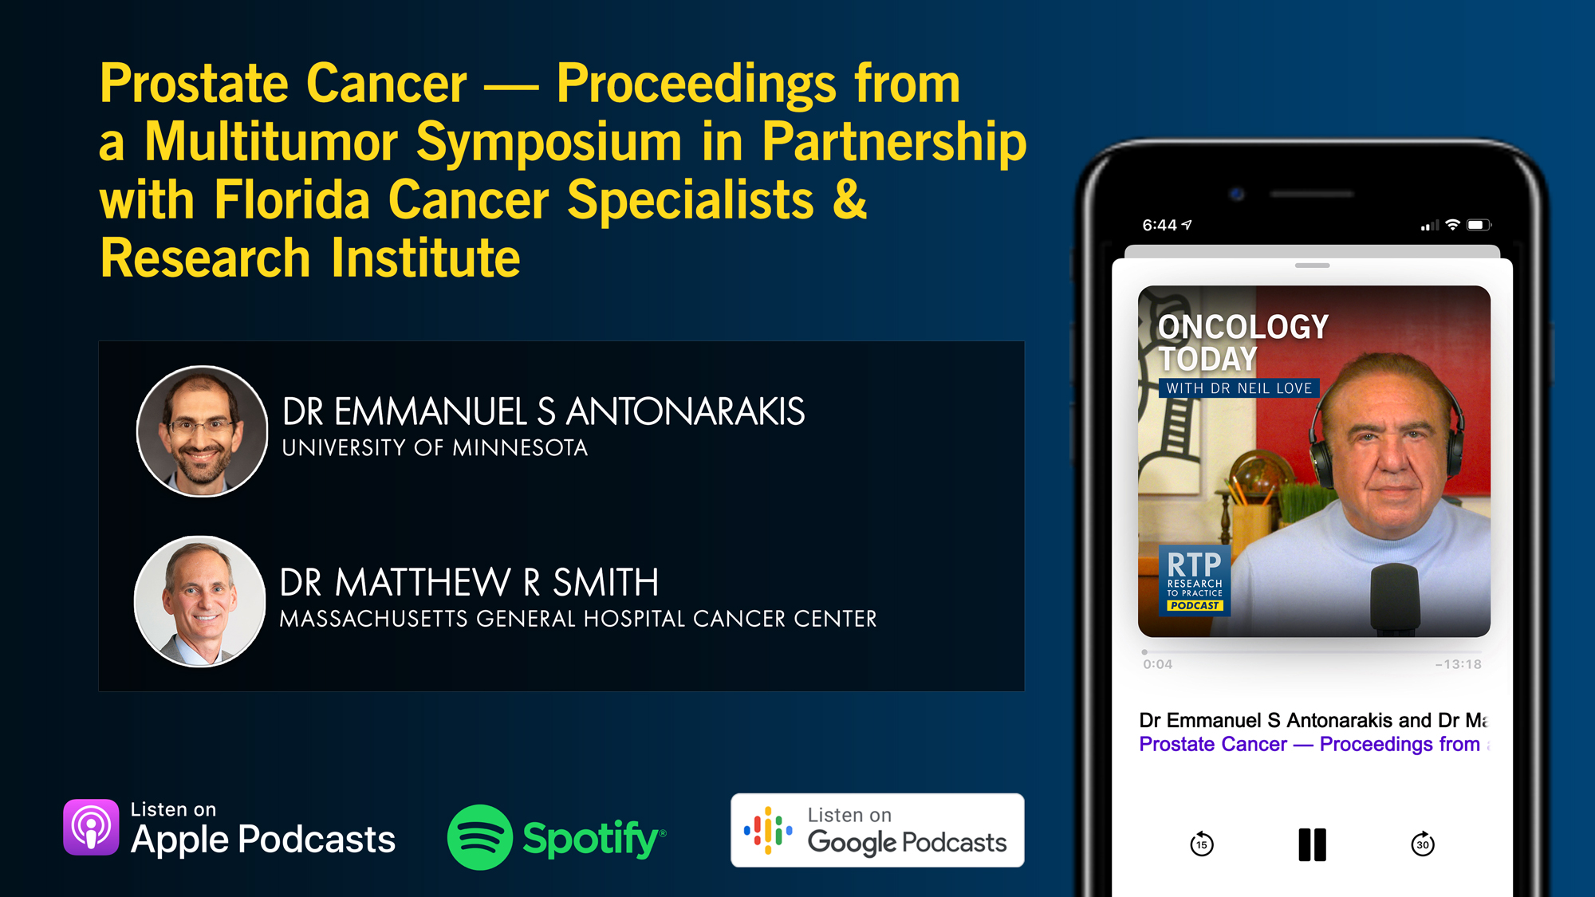

Slide 14
Exciting CME Events You Do Not Want to Miss
A Friday Satellite Symposium Series Preceding the 67th ASH Annual Meeting
Friday, December 5, 2025
Acute Myeloid Leukemia
7:30 AM – 9:30 AM ET
Myelofibrosis and
Systemic Mastocytosis
3:15 PM – 5:15 PM ET
Chronic Lymphocytic Leukemia
11:30 AM – 1:30 PM ET
Follicular Lymphoma and
Diffuse Large B-Cell Lymphoma
7:00 PM – 9:00 PM ET

Slide 15
Cases from the Community: Investigators Discuss the
Optimal Management of Breast Cancer
A 3-Part CME Satellite Symposium Series
Antibody-Drug Conjugates for
Metastatic Breast Cancer
Tuesday, December 9, 2025
7:00 PM – 8:30 PM CT
HER2-Positive Breast Cancer
Wednesday, December 10, 2025
7:00 PM – 9:00 PM CT
Endocrine-Based Therapy
Thursday, December 11, 2025
7:00 PM – 9:00 PM CT
Moderator
Neil Love, MD

Slide 16
Hematologic Cancers: A 3-Part ASH 2025 Review
A CME/MOC-Accredited Webinar Series
Relapsed/Refractory
Multiple Myeloma
Monday, December 15, 2025
5:00 PM – 6:00 PM ET
Immune Thrombocytopenia
Tuesday, December 16, 2025
5:00 PM – 6:30 PM ET
Bispecific Antibodies in Lymphoma
Wednesday, December 17, 2025
5:00 PM – 6:00 PM ET
Moderator
Neil Love, MD

Slide 17
Grand Rounds
CME/MOC-Accredited Interactive Series
November 2025 to April 2026
Three Series
Optimizing Treatment
for Patients with Relapsed/Refractory Chronic Lymphocytic Leukemia
Optimizing the Use of
Novel Therapies for Patients with Diffuse
Large B-Cell Lymphoma
Optimizing Therapy for Patients with Hormone Receptor-Positive
Localized Breast Cancer
Host a 1-hour session at your institution:
Email Meetings@ResearchToPractice.com
or call (800) 233-6153

Slide 18

Save The Date
A Multitumor CME/MOC-, NCPD- and ACPE-Accredited Educational Conference Developed in Partnership with Florida Cancer Specialists & Research Institute
Friday to Sunday, April 24 to 26, 2026
The Ritz-Carlton Orlando, Grande Lakes | Orlando, Florida
Moderated by Neil Love, MD

Slide 19
Thank you for joining us! Please take a moment to complete the survey currently up on Zoom.
Your feedback is very important to us.
Information on how to obtain CME, ABIM MOC and ABS credit will be provided at the conclusion of the activity in the Zoom chat room. Attendees will also receive an email in 1 to 3 business days with these instructions.

Slide 20
Cancer Conference Update: ESMO Congress 2025 —
Urothelial Bladder Cancer and Prostate Cancer
A CME/MOC-Accredited Live Webinar
Thursday, November 20, 2025​
5:00 PM – 6:00 PM ET
Faculty
Terence Friedlander, MD
Rana R McKay, MD
Moderator
Neil Love, MD

Slide 21
Faculty
Terence Friedlander, MD
Professor of Medicine and Robert and Virginia O’Reilly Family Endowed Chair
Chief, Division of Hematology/Oncology
Zuckerberg San Francisco General Hospital
Helen Diller Family Comprehensive Cancer Center
University of California, San Francisco
San Francisco, California
MODERATOR
Neil Love, MD
Research To Practice
Miami, Florida
Rana R McKay, MD
Professor of Medicine and Urology
Associate Director, Clinical Research
Co-Lead, Genitourinary Program
Moores Cancer Center
University of California San Diego
San Diego, California

Slide 22
We Encourage Clinicians in Practice to Submit Questions
Feel free to submit questions now before the program begins and throughout the program.

Slide 23
Clinicians in the Audience, Please Complete the Pre- and Postmeeting Surveys
Quick Survey
Quick Poll

Slide 25
Exciting CME Events You Do Not Want to Miss
A Friday Satellite Symposium Series Preceding the 67th ASH Annual Meeting
Friday, December 5, 2025
Acute Myeloid Leukemia
7:30 AM – 9:30 AM ET
Myelofibrosis and
Systemic Mastocytosis
3:15 PM – 5:15 PM ET
Chronic Lymphocytic Leukemia
11:30 AM – 1:30 PM ET
Follicular Lymphoma and
Diffuse Large B-Cell Lymphoma
7:00 PM – 9:00 PM ET

Slide 26
Cases from the Community: Investigators Discuss the
Optimal Management of Breast Cancer
A 3-Part CME Satellite Symposium Series
Antibody-Drug Conjugates for
Metastatic Breast Cancer
Tuesday, December 9, 2025
7:00 PM – 8:30 PM CT
HER2-Positive Breast Cancer
Wednesday, December 10, 2025
7:00 PM – 9:00 PM CT
Endocrine-Based Therapy
Thursday, December 11, 2025
7:00 PM – 9:00 PM CT
Moderator
Neil Love, MD

Slide 27
Hematologic Cancers: A 3-Part ASH 2025 Review
A CME/MOC-Accredited Webinar Series
Relapsed/Refractory
Multiple Myeloma
Monday, December 15, 2025
5:00 PM – 6:00 PM ET
Immune Thrombocytopenia
Tuesday, December 16, 2025
5:00 PM – 6:30 PM ET
Bispecific Antibodies in Lymphoma
Wednesday, December 17, 2025
5:00 PM – 6:00 PM ET
Moderator
Neil Love, MD

Slide 28
Grand Rounds
CME/MOC-Accredited Interactive Series
November 2025 to April 2026
Three Series
Optimizing Treatment
for Patients with Relapsed/Refractory Chronic Lymphocytic Leukemia
Optimizing the Use of
Novel Therapies for Patients with Diffuse
Large B-Cell Lymphoma
Optimizing Therapy for Patients with Hormone Receptor-Positive
Localized Breast Cancer
Host a 1-hour session at your institution:
Email Meetings@ResearchToPractice.com
or call (800) 233-6153

Slide 29
Save The Date
A Multitumor CME/MOC-, NCPD- and ACPE-Accredited Educational Conference Developed in Partnership with Florida Cancer Specialists & Research Institute
Friday to Sunday, April 24 to 26, 2026
The Ritz-Carlton Orlando, Grande Lakes | Orlando, Florida
Moderated by Neil Love, MD

Slide 30
Cancer Conference Update: ESMO Congress 2025 —
Urothelial Bladder Cancer and Prostate Cancer
A CME/MOC-Accredited Live Webinar
Thursday, November 20, 2025​
5:00 PM – 6:00 PM ET
Faculty
Terence Friedlander, MD
Rana R McKay, MD
Moderator
Neil Love, MD

Slide 31
Dr Friedlander — Disclosures
Advisory Committees | Aadi Bioscience, AbbVie Inc, Adaptimmune, Astellas, Aktis Oncology, Bicycle Therapeutics, Bristol Myers Squibb, Gilead Sciences Inc, Merck, Pfizer Inc, Samsung Bioepis
Consulting Agreements | Astellas, EMD Serono Inc, Genentech, a member of the Roche Group
Contracted Research | AbbVie Inc, Bicycle Therapeutics, Flare Therapeutics, Genentech, a member of the Roche Group, Johnson & Johnson, Pfizer Inc

Slide 32
Dr McKay — Disclosures
Advisor/Consultant | Ambrx, Arcus Biosciences, AstraZeneca Pharmaceuticals LP, Aveo Pharmaceuticals, Bayer HealthCare Pharmaceuticals, Blue Earth Diagnostics, Bristol Myers Squibb, Calithera Biosciences, Caris Life Sciences, Daiichi Sankyo Inc, Dendreon Pharmaceuticals Inc, Exelixis Inc, Johnson & Johnson, Lilly, Merck, Myovant Sciences, Neomorph, Novartis, Pfizer Inc, Sanofi, Seagen Inc, Sorrento Therapeutics, Telix Pharmaceuticals Limited, Tempus
Institutional Research Funding | Artera, AstraZeneca Pharmaceuticals LP, Bayer HealthCare Pharmaceuticals, Bristol Myers Squibb, Exelixis Inc, Oncternal Therapeutics, Tempus

Slide 33
Dr Love — Disclosures
Dr Love is president and CEO of Research To Practice. Research To Practice receives funds in the form of educational grants to develop CME activities from the following companies: Aadi Bioscience, AbbVie Inc, ADC Therapeutics, Agendia Inc, Alexion Pharmaceuticals, Amgen Inc, Array BioPharma Inc, a subsidiary of Pfizer Inc, Arvinas, Astellas, AstraZeneca Pharmaceuticals LP, Aveo Pharmaceuticals, Bayer HealthCare Pharmaceuticals, BeOne, Black Diamond Therapeutics Inc, Blueprint Medicines, Boehringer Ingelheim Pharmaceuticals Inc, Bristol Myers Squibb, Celcuity, Clovis Oncology, Coherus BioSciences, Corcept Therapeutics Inc, CTI BioPharma, a Sobi Company, Daiichi Sankyo Inc, Eisai Inc, Elevation Oncology Inc, Exact Sciences Corporation, Exelixis Inc, Genentech, a member of the Roche Group, Genmab US Inc, Geron Corporation, Gilead Sciences Inc, GSK, Helsinn Therapeutics (US) Inc, Hologic Inc, ImmunoGen Inc, Incyte Corporation, Ipsen Biopharmaceuticals Inc, Jazz Pharmaceuticals Inc, Johnson & Johnson, Karyopharm Therapeutics, Kite, A Gilead Company, Kura Oncology, Legend Biotech, Lilly, MEI Pharma Inc, Merck, Mersana Therapeutics Inc, Mirati Therapeutics Inc, Mural Oncology Inc, Natera Inc, Novartis, Novartis Pharmaceuticals Corporation on behalf of Advanced Accelerator Applications, Novocure Inc, Nuvalent, Pfizer Inc, Pharmacyclics LLC, an AbbVie Company, Puma Biotechnology Inc, Regeneron Pharmaceuticals Inc, Rigel Pharmaceuticals Inc, R-Pharm US, Sanofi, Seagen Inc, Servier Pharmaceuticals LLC, SpringWorks Therapeutics Inc, Stemline Therapeutics Inc, Sumitomo Pharma America, Syndax Pharmaceuticals, Taiho Oncology Inc, Takeda Pharmaceuticals USA Inc, TerSera Therapeutics LLC, and Tesaro, A GSK Company.

Slide 34
Commercial Support
This activity is supported by educational grants from AstraZeneca Pharmaceuticals LP and Natera Inc.
Research To Practice CME Planning Committee Members,
Staff and Reviewers
Planners, scientific staff and independent reviewers for Research To Practice have no relevant conflicts of interest to disclose.

Slide 35
This educational activity contains discussion of
non-FDA-approved uses of agents and regimens. Please refer to official prescribing information for each product for approved indications.

Slide 36
Agenda
Module 1: Prostate Cancer
Capivasertib for Metastatic Hormone-Sensitive Prostate Cancer (mHSPC)
PARP Inhibitors and Androgen Receptor Pathway Inhibitors (ARPIs) for Metastatic Prostate Cancer
Biochemically Recurrent Prostate Cancer
Lutetium Lu 177 Vipivotide Tetraxetan for mHSPC
Radiation Therapy and Androgen Deprivation Therapy with or without an ARPI
Module 2: Urothelial Bladder Cancer
Neoadjuvant and Perioperative Treatment Approaches for Muscle Invasive Bladder Cancer (MIBC)
Circulating Tumor DNA and Adjuvant Immunotherapy for MIBC
HER2-Targeted Antibody-Drug Conjugates for Metastatic Urothelial Bladder Cancer (mUBC)
Targeting TROP2 in mUBC
Immunotherapy and BCG for Non-Muscle-Invasive Bladder Cancer

Slide 37
Agenda
Module 1: Prostate Cancer
Capivasertib for Metastatic Hormone-Sensitive Prostate Cancer (mHSPC)
PARP Inhibitors and Androgen Receptor Pathway Inhibitors (ARPIs) for Metastatic Prostate Cancer
Biochemically Recurrent Prostate Cancer
Lutetium Lu 177 Vipivotide Tetraxetan for mHSPC
Radiation Therapy and Androgen Deprivation Therapy with or without an ARPI
Module 2: Urothelial Bladder Cancer
Neoadjuvant and Perioperative Treatment Approaches for Muscle Invasive Bladder Cancer (MIBC)
Circulating Tumor DNA and Adjuvant Immunotherapy for MIBC
HER2-Targeted Antibody-Drug Conjugates for Metastatic Urothelial Bladder Cancer (mUBC)
Targeting TROP2 in mUBC
Immunotherapy and BCG for Non-Muscle-Invasive Bladder Cancer

Slide 38
Key Datasets in Prostate Cancer
Fizazi K et al. A phase III study of capivasertib (capi) + abiraterone (abi) vs placebo (pbo) + abi in patients (pts) with PTEN deficient de novo metastatic hormone-sensitive prostate cancer (mHSPC): CAPItello-281. ESMO 2025;Abstract 2383O.
Azad A et al. First interim efficacy analysis of the phase I/II PETRANHA trial of saruparib + androgen receptor pathway inhibitors (ARPI) in patients (pts) with metastatic prostate cancer (mPC). ESMO 2025;Abstract 2384MO.
Galceran JC et al. Time to response with talazoparib (TALA) + enzalutamide (ENZA) in patients (pts) with metastatic castration-resistant prostate cancer (mCRPC) in TALAPRO-2. ESMO 2025;Abstract 2428P.
Freedland S et al. EMBARK: Overall survival with enzalutamide in biochemically recurrent prostate cancer. ESMO 2025;Abstract LBA87.
Aggarwal R et al. Final results from PRESTO: A phase III open-label study of combined androgen blockade in patients (pts) with high-risk biochemically relapsed prostate cancer (BRPC) (AFT-19). ESMO 2025;Abstract LBA88.

Slide 39
Key Datasets in Prostate Cancer (Continued)
Tagawa S et al. Phase III trial of [177Lu]Lu-PSMA-617 combined with ADT + ARPI in patients with PSMA-positive metastatic hormone-sensitive prostate cancer (PSMAddition). ESMO 2025;Abstract LBA6.
Nguyen P et al. Randomised phase III trial of androgen deprivation therapy (ADT) with radiation therapy with or without enzalutamide for high risk, clinically localised prostate cancer: ENZARAD (ANZUP 1303). ESMO 2025;Abstract LBA86.

Slide 40
Capivasertib for mHSPC
Fizazi K et al. A phase III study of capivasertib (capi) + abiraterone (abi) vs placebo (pbo) + abi in patients (pts) with PTEN deficient de novo metastatic hormone-sensitive prostate cancer (mHSPC): CAPItello-281. ESMO 2025;Abstract 2383O.

Slide 41
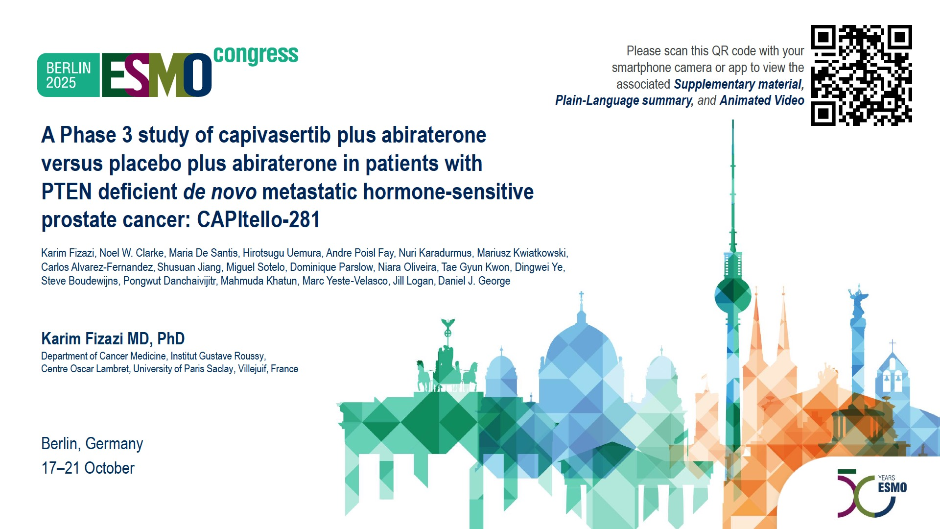
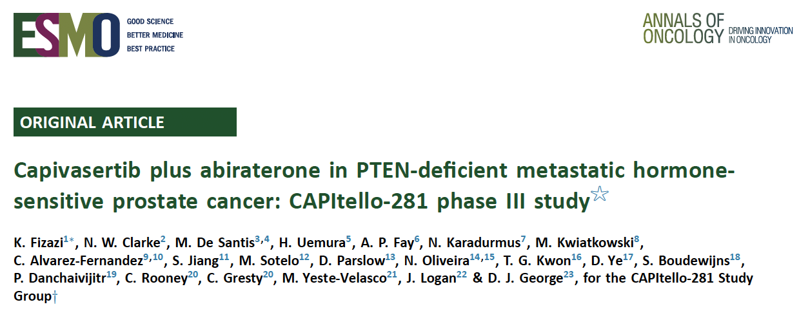
Abstract 2383O

Slide 42
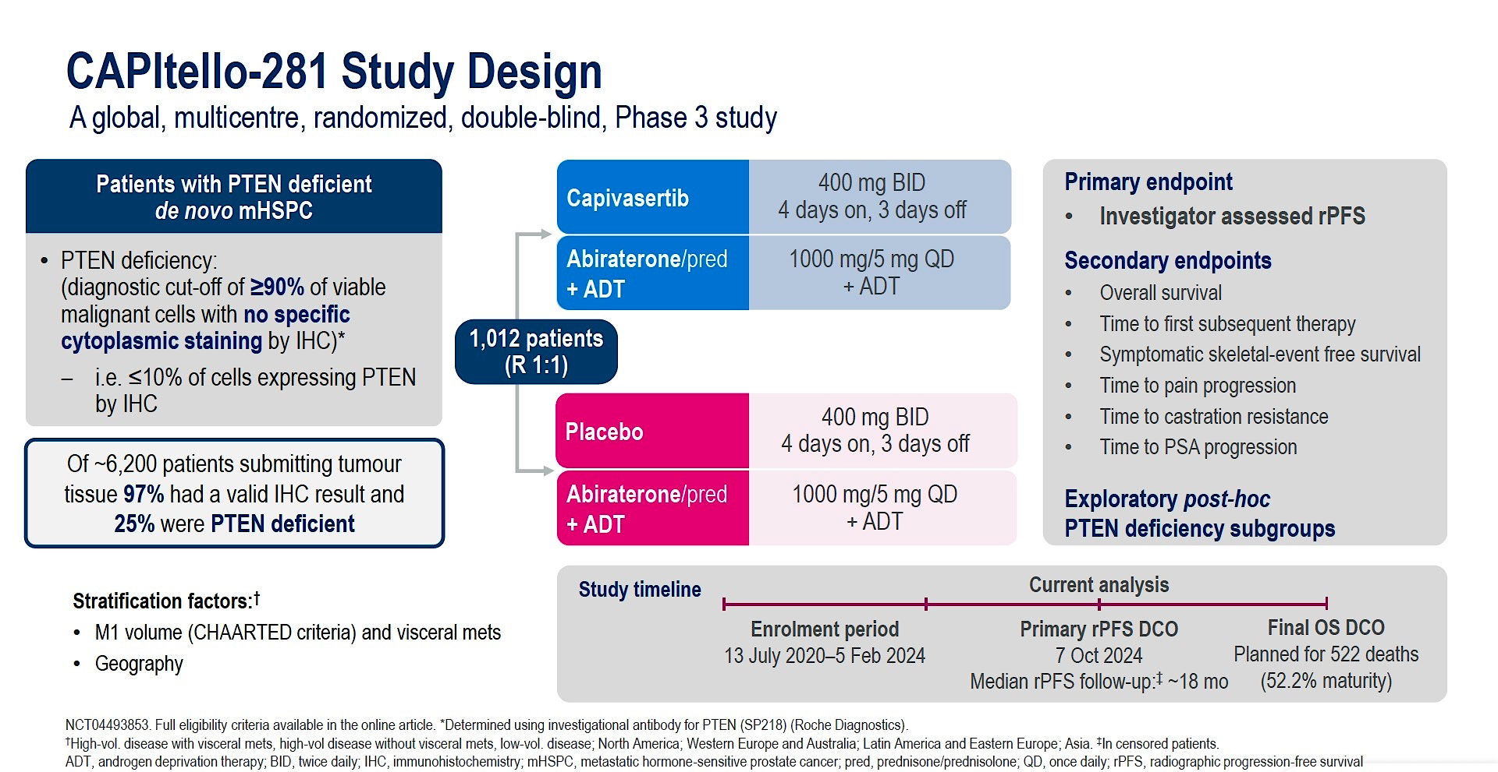
Phase III CAPItello-281 Study Design
Fizazi K et al. ESMO 2025;Abstract 2383O.

Slide 43
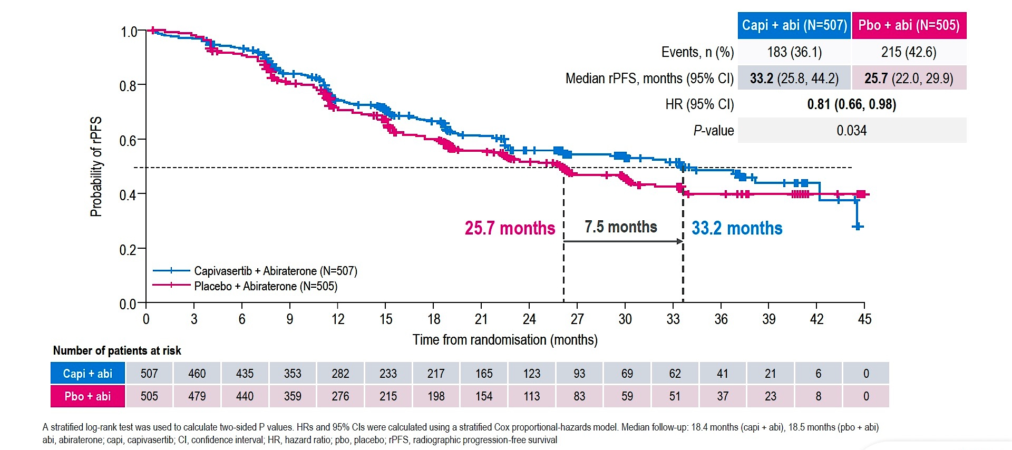
Phase III CAPItello-281: Investigator-Assessed rPFS
Fizazi K et al. ESMO 2025;Abstract 2383O.
Fizazi K et al. Ann Oncol. 2025 Oct 19:S0923-7534(25)04936-1.

Slide 44
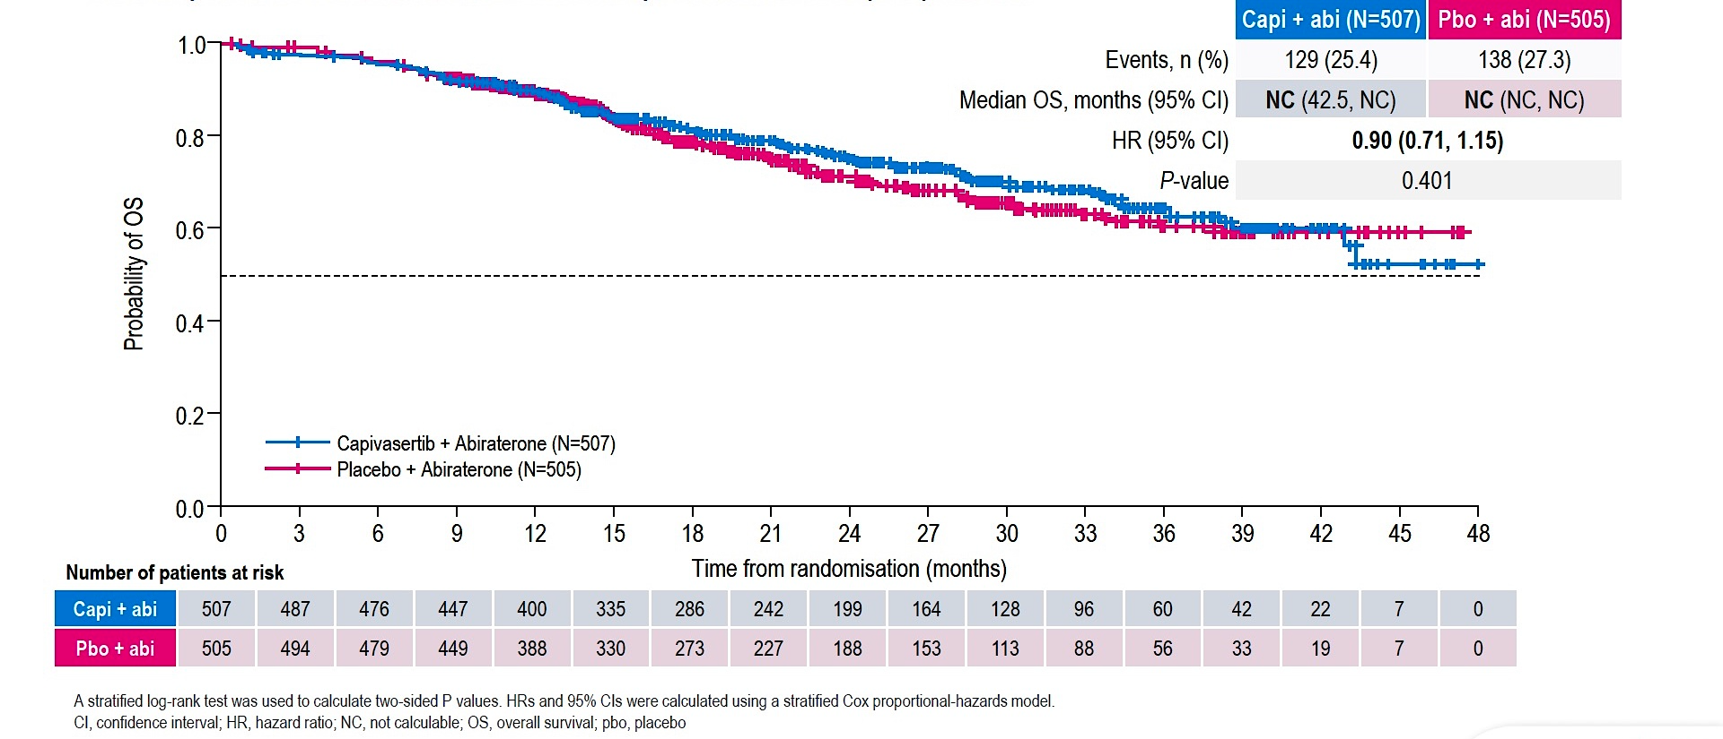
Phase III CAPItello-281: Interim OS
Fizazi K et al. ESMO 2025;Abstract 2383O.
Fizazi K et al. Ann Oncol. 2025 Oct 19:S0923-7534(25)04936-1.

Slide 45
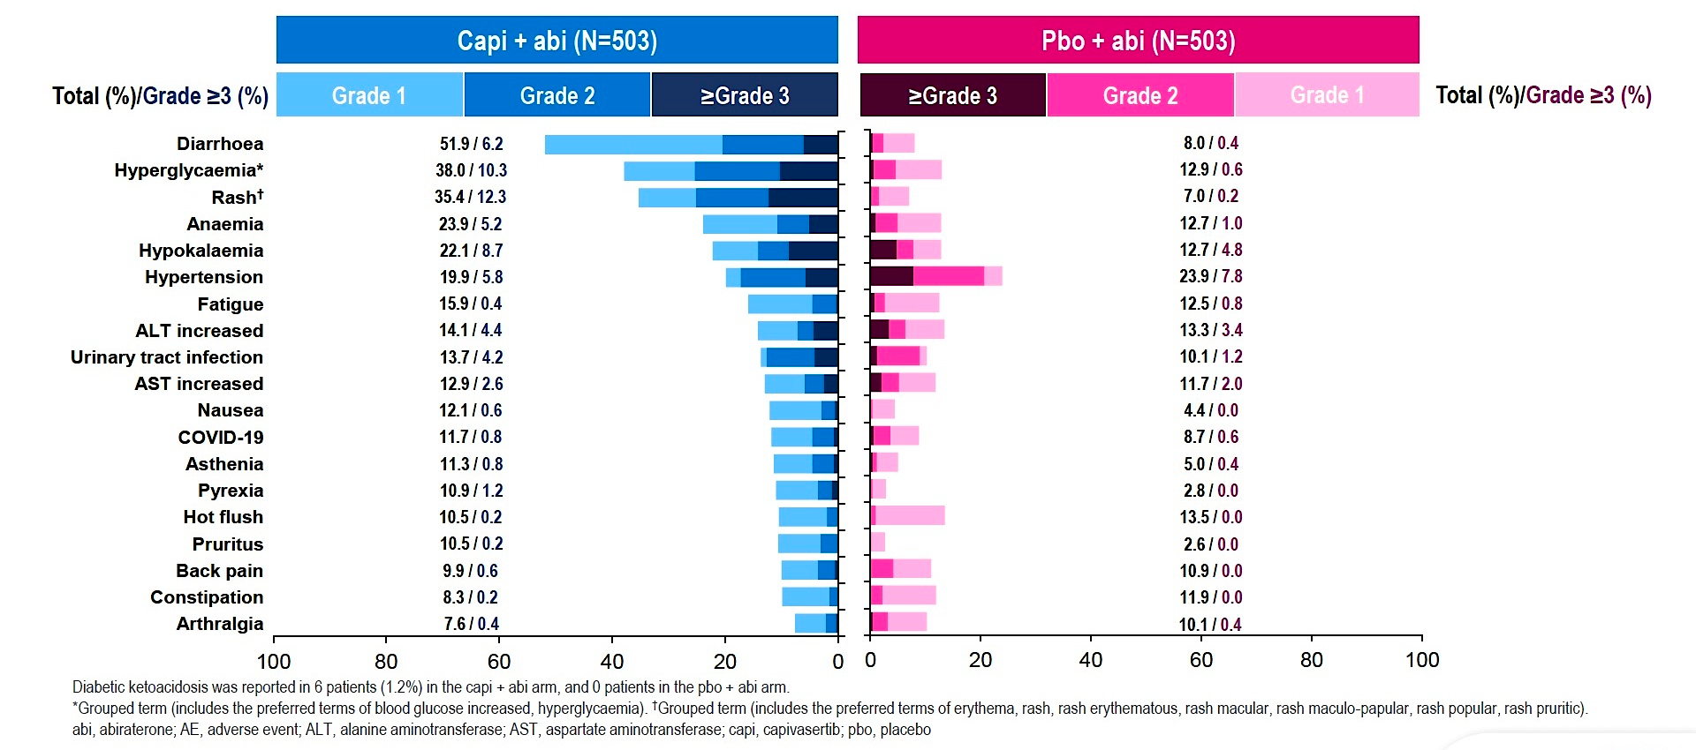
Phase III CAPItello-281: Common Adverse Events
Fizazi K et al. ESMO 2025;Abstract 2383O.
Fizazi K et al. Ann Oncol. 2025 Oct 19:S0923-7534(25)04936-1.

Slide 46
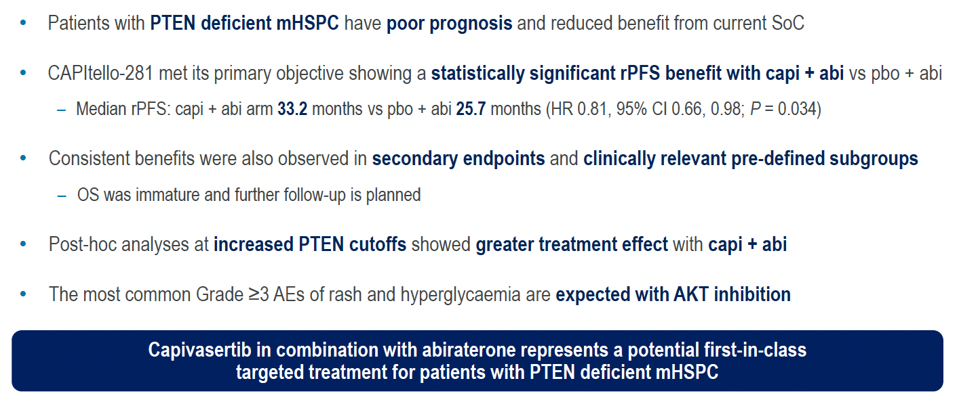
Phase III CAPItello-281: Authors’ Conclusions
Fizazi K et al. ESMO 2025;Abstract 2383O.
Fizazi K et al. Ann Oncol. 2025 Oct 19:S0923-7534(25)04936-1.

Slide 47
Dr McKay: Case Presentation
Patient: 66-year-old male
Clinical Course:
De novo metastatic high-volume disease diagnosed February 2025
Prostate biopsy: Gleason 5+4=9, PSA 287 ng/mL
Widespread bone metastases throughout axial and appendicular skeleton
Multiple bilateral lung metastases (largest 1.4 cm)
Genomic sequencing of prostate biopsy tissue revealed PTEN loss
IHC confirmed PTEN loss in 95% of tumor cells
Started ADT + abiraterone 1000 mg daily with prednisone in March 2025
Added capivasertib 200 mg BID (4 days on/3 days off schedule) based on PTEN loss
Given instructions to start loperamide at first episode of diarrhea
Initiated close lab monitoring including glucose monitoring

Slide 48
PARP Inhibitors and Androgen Receptor Pathway Inhibitors for Metastatic Prostate Cancer
Azad A et al. First interim efficacy analysis of the phase I/II PETRANHA trial of saruparib + androgen receptor pathway inhibitors (ARPI) in patients (pts) with metastatic prostate cancer (mPC). ESMO 2025;Abstract 2384MO.
Galceran JC et al. Time to response with talazoparib (TALA) + enzalutamide (ENZA) in patients (pts) with metastatic castration-resistant prostate cancer (mCRPC) in TALAPRO-2. ESMO 2025;Abstract 2428P.

Slide 49
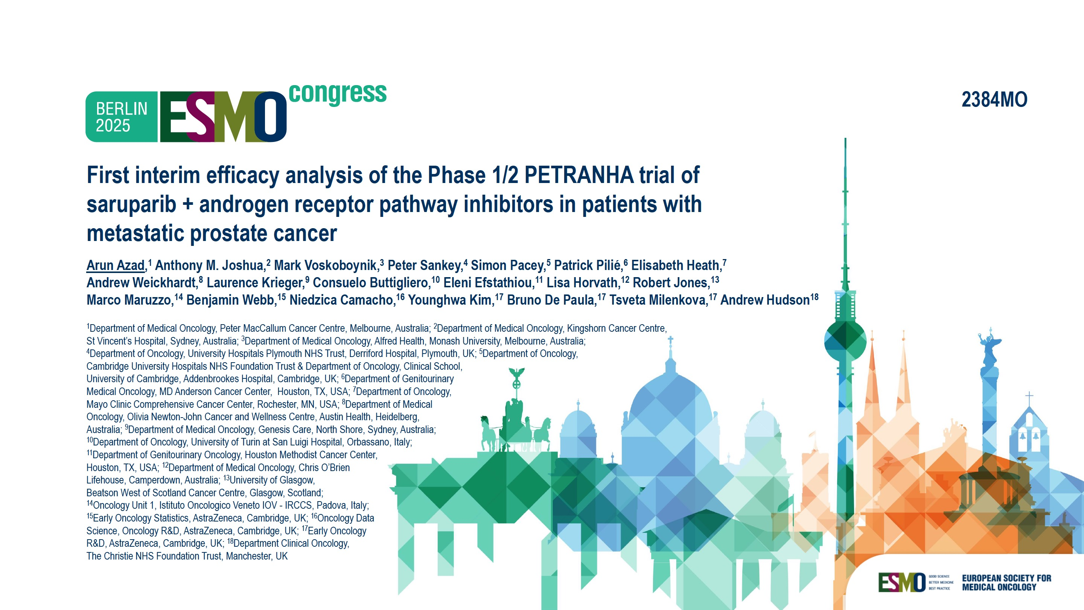
Abstract 2384MO

Slide 50
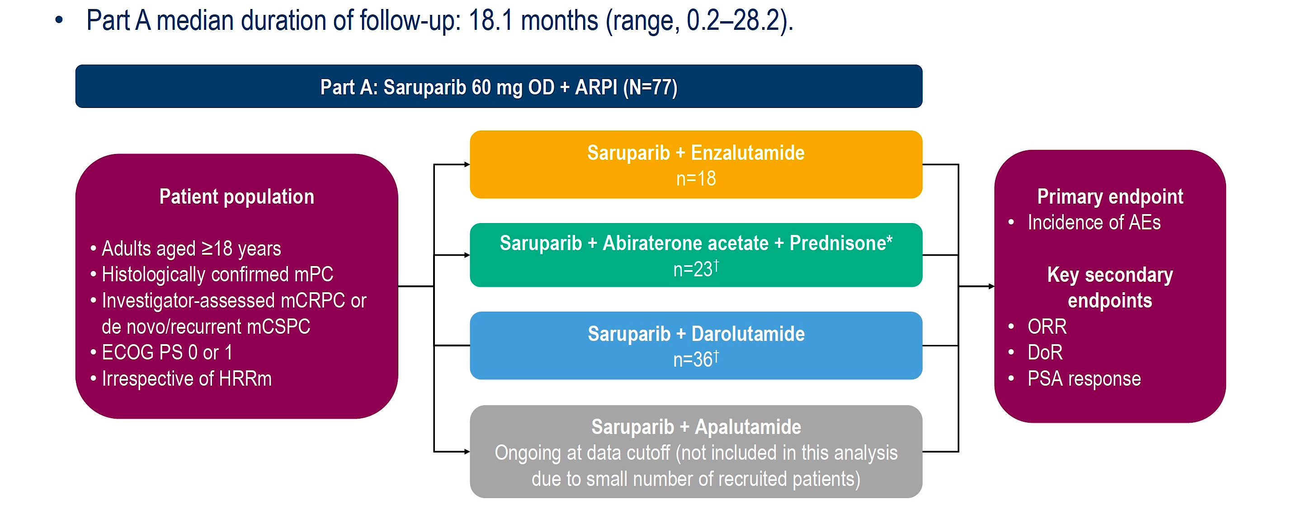
Phase I/II PETRANHA Study Design
Azad A et al. ESMO 2025;Abstract 2384MO.

Slide 51
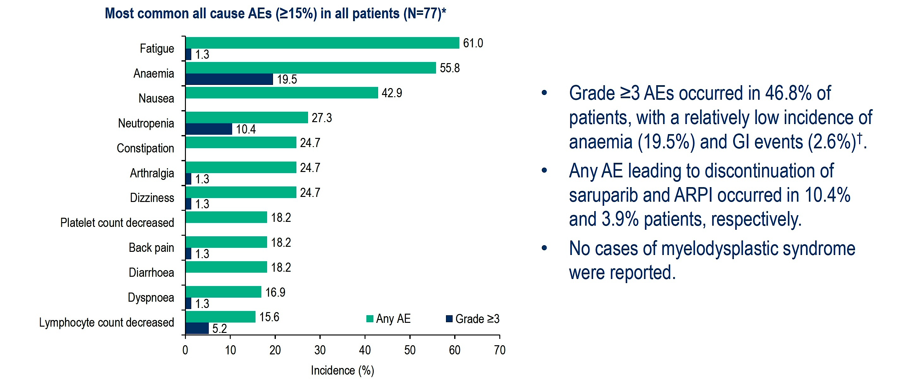
Phase I/II PETRANHA Primary Endpoint: Incidence of Adverse Events (AEs)
Azad A et al. ESMO 2025;Abstract 2384MO.

Slide 52
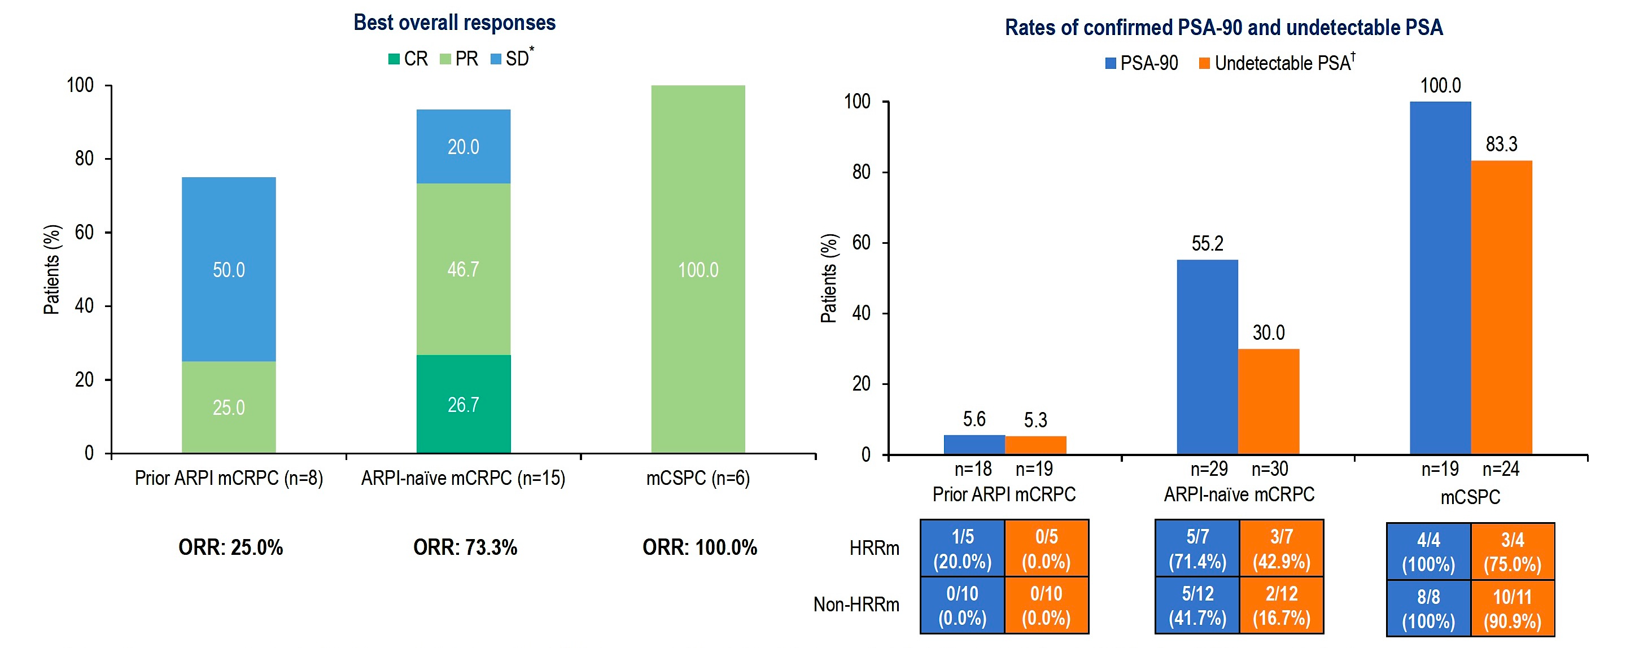
Phase I/II PETRANHA: Responses
Azad A et al. ESMO 2025;Abstract 2384MO.

Slide 53
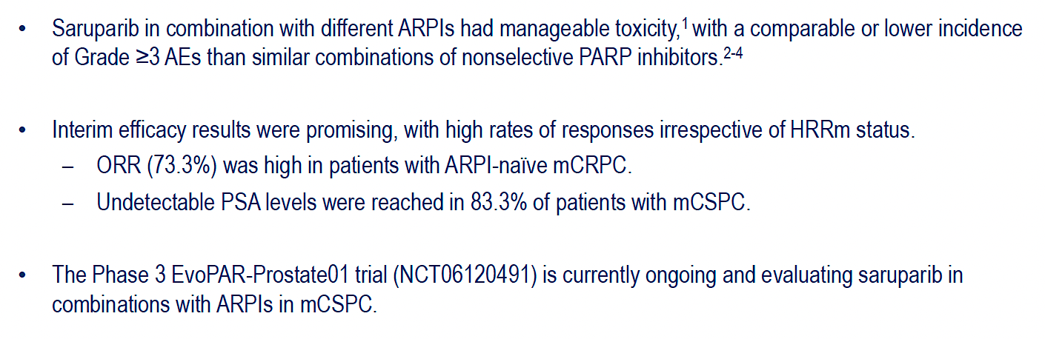
Phase I/II PETRANHA: Authors’ Conclusions
Azad A et al. ESMO 2025;Abstract 2384MO.

Slide 54
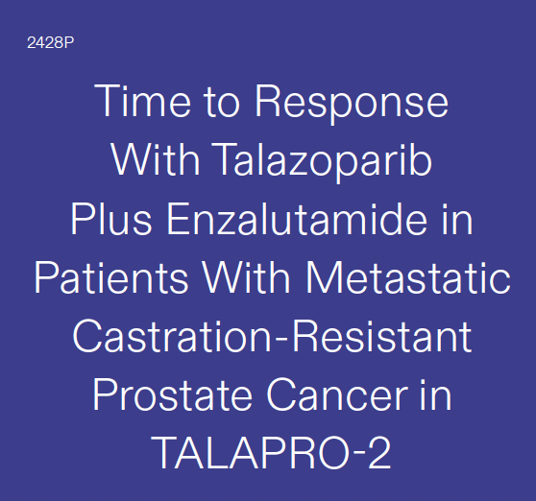
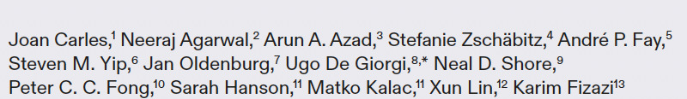

Slide 55
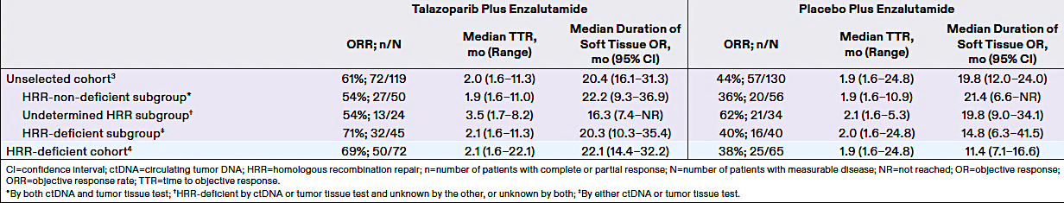
Phase III TALAPRO-2 Study: ORR, Time to Response and Duration of Objective Response
Galceran JC et al. ESMO 2025;Abstract 2428P.

Slide 56
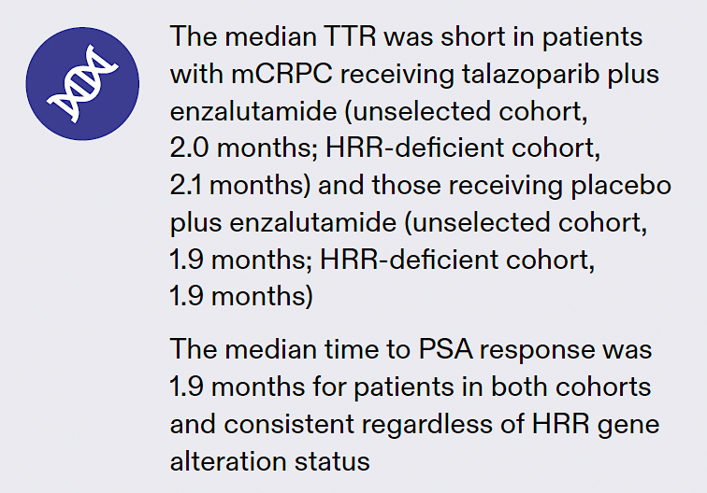
Phase III TALAPRO-2: Authors’ Conclusions
TTR = time to response; mCRPC = metastatic castration-resistant prostate cancer; HRR = homologous recombination repair; PSA = prostate-specific antigen
Galceran JC et al. ESMO 2025;Abstract 2428P.

Slide 57
Dr McKay: Case Presentation
Patient: 63-year-old male
Clinical Course:
Initial diagnosis 2019: Gleason 4+4=8, PSA 18.7 ng/mL, T3a disease on MRI
Treated with definitive radiation therapy + ADT for 2 years
PSA nadir 0.34 ng/mL after completion of therapy
2022: Rising PSA with rapid doubling time of 3 months
CT CAP and bone scan revealed retroperitoneal lymph nodes and 4 bone metastases in spine and pelvis
Restarted ADT in late 2022
PSA responded well, dropping to 0.56 ng/mL
Maintained response for 1.5 years

Slide 58
Dr McKay: Case Presentation (Continued)
Clinical Course:
Mid-2024: PSA rising to 5.6 ng/mL with imaging showing disease progression
CT CAP and bone scan demonstrated retroperitoneal lymph nodes and 4 bone metastases in the pelvis and spine.
Germline testing revealed BRCA2 mutation
Somatic tumor profiling from original RP specimen also showed BRCA2 mutation
Started olaparib 300 mg BID + abiraterone 1000 mg daily with prednisone in April 2025
PSA decreased from 12.8 to 0.9 ng/mL after 7 months
Tolerating therapy with fatigue, anemia requiring initial dose hold, then resuming with same dose with stability of anemia

Slide 59
Biochemically Recurrent Prostate Cancer
Freedland S et al. EMBARK: Overall survival with enzalutamide in biochemically recurrent prostate cancer. ESMO 2025;Abstract LBA87.
Aggarwal R et al. Final results from PRESTO: A phase III open-label study of combined androgen blockade in patients (pts) with high-risk biochemically relapsed prostate cancer (BRPC) (AFT-19). ESMO 2025;Abstract LBA88.

Slide 60

Abstract LBA87

Slide 61
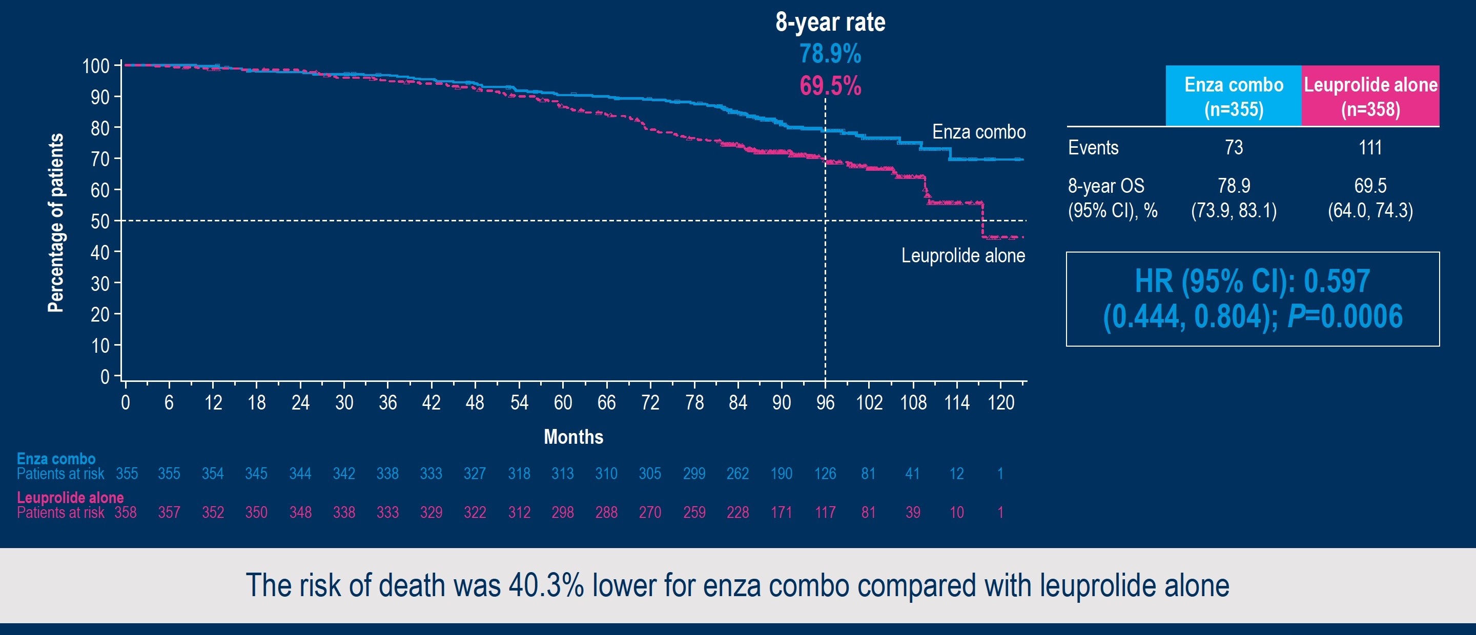
Phase III EMBARK: Overall Survival with Enzalutamide Combination
Freedland S et al. ESMO 2025;Abstract LBA87.

Slide 62
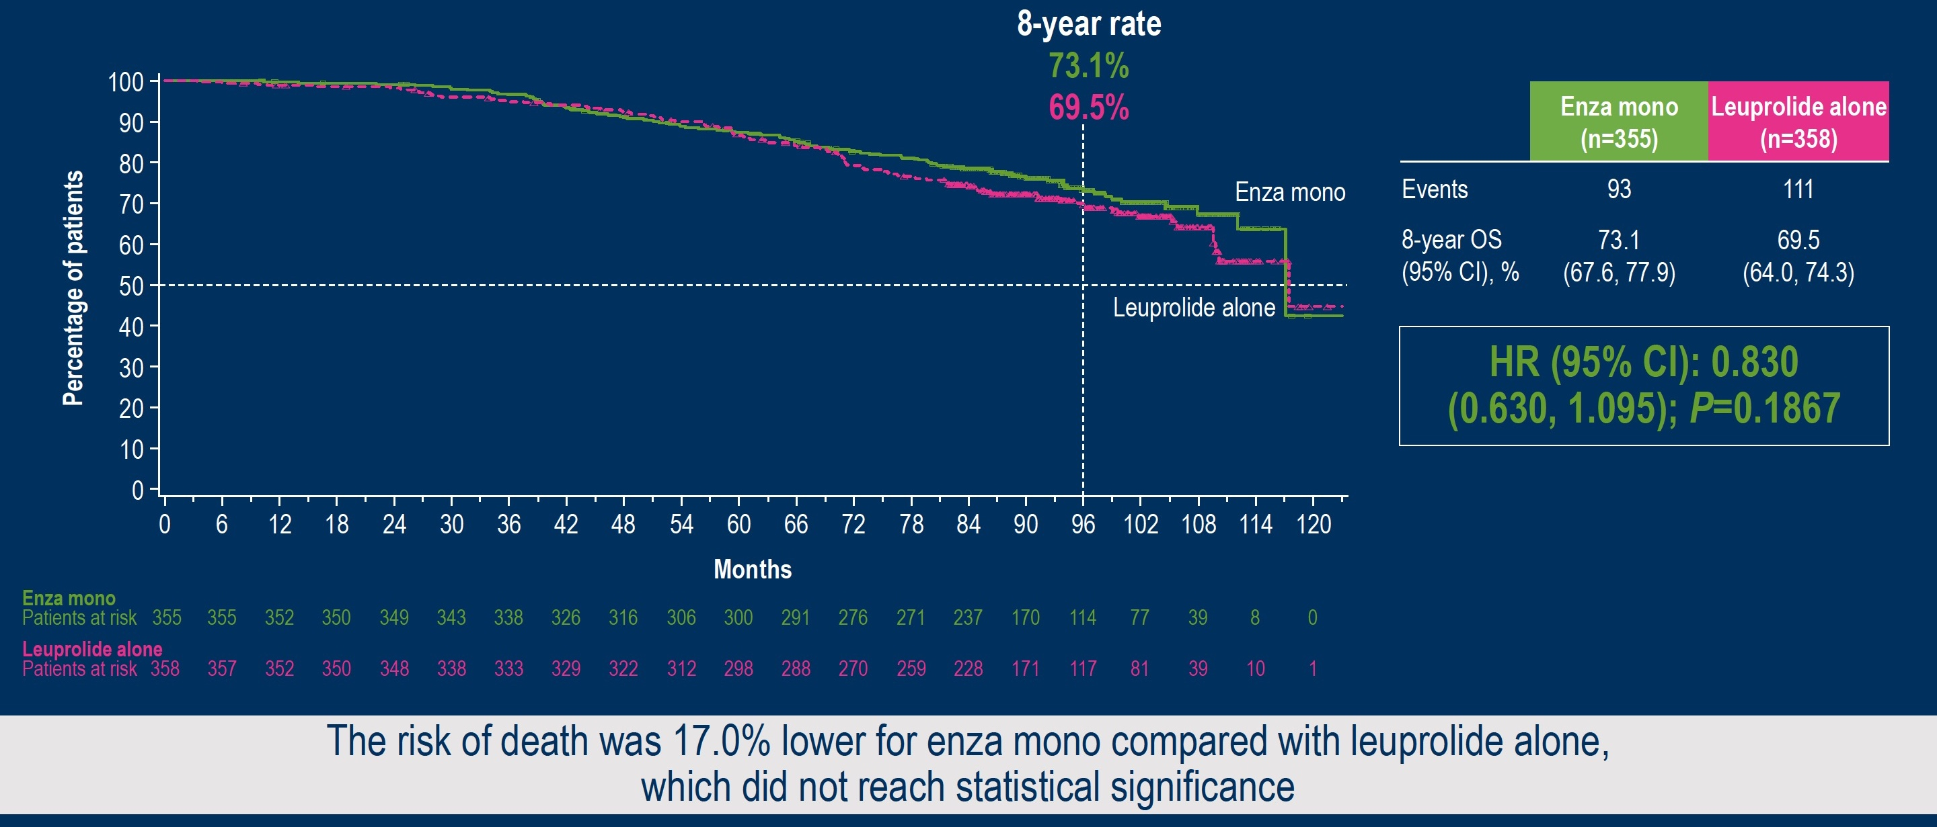
Phase III EMBARK: Overall Survival with Enzalutamide Monotherapy
Freedland S et al. ESMO 2025;Abstract LBA87.

Slide 63
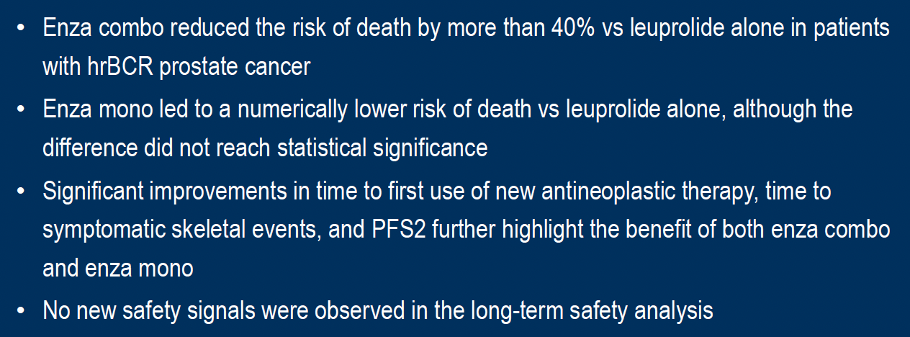
Phase III EMBARK: Authors’ Conclusions
Freedland S et al. ESMO 2025;Abstract LBA87.

Slide 64

Abstract LBA88

Slide 65
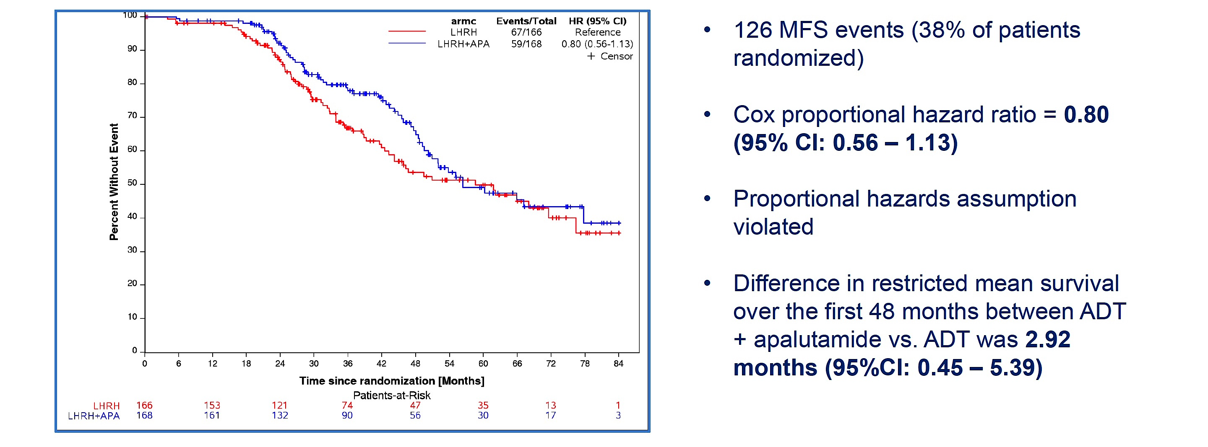
Phase III PRESTO: Metastases-Free Survival (MFS) with Androgen Deprivation Therapy (ADT) and Apalutamide versus ADT
Aggarwal R et al. ESMO 2025;Abstract LBA88.

Slide 66
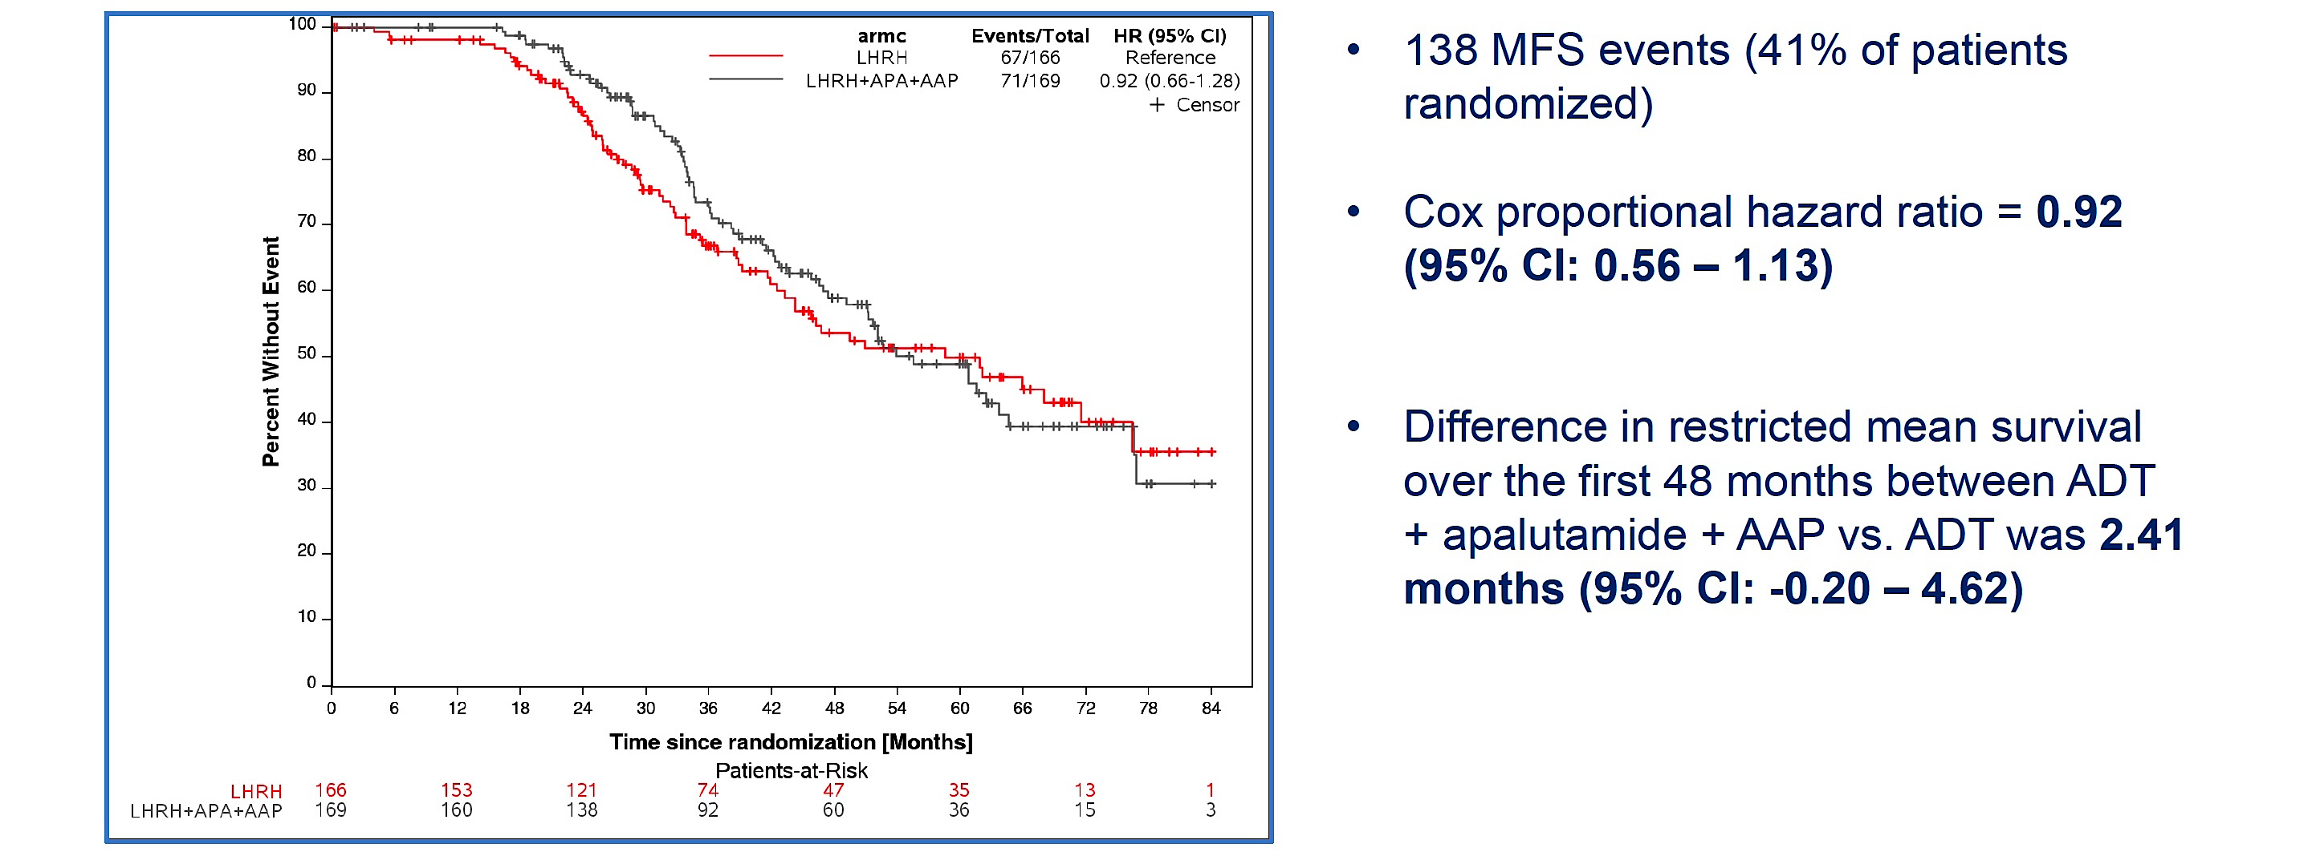
Phase III PRESTO: Metastases-Free Survival with ADT Combined with Apalutamide + Abiraterone Acetate with Prednisone (AAP) versus ADT
Aggarwal R et al. ESMO 2025;Abstract LBA88.

Slide 67
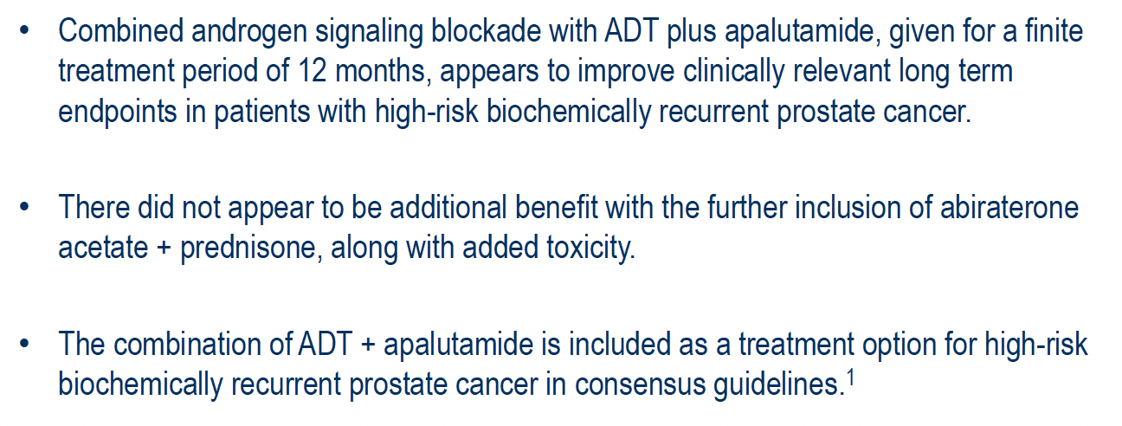
Phase III PRESTO: Authors’ Conclusions
Aggarwal R et al. ESMO 2025;Abstract LBA88.

Slide 68
Dr McKay: Case Presentation
Patient: 68-year-old male
Clinical Course:
Initial diagnosis: Gleason 4+4=8 prostate adenocarcinoma, PSA 12.3 ng/mL
Underwent radical prostatectomy in 2021
Post-operative PSA nadir: 0.02 ng/mL
PSA rose to 0.25 ng/mL by early 2023
Received salvage radiation therapy (70 Gy) without ADT
PSA nadir post-radiation: 0.02 ng/mL
PSA began rising again in 2024, reaching 1.2 ng/mL by January 2025
PSA doubling time: 6 months

Slide 69
Dr McKay: Case Presentation (Continued)
Clinical Course:
Conventional imaging negative (CT/bone scan)
PSMA PET/CT showed no definitive metastatic disease
Started on enzalutamide 160 mg daily without ADT in February 2025
PSA decreased to <0.01. Testosterone also decreased to castrate levels.
Completed 1 year of therapy and then discontinued treatment.

Slide 70
Lutetium Lu 177 Vipivotide Tetraxetan for mHSPC
Tagawa S et al. Phase III trial of [177Lu]Lu-PSMA-617 combined with ADT + ARPI in patients with PSMA-positive metastatic hormone-sensitive prostate cancer (PSMAddition). ESMO 2025;Abstract LBA6.

Slide 71
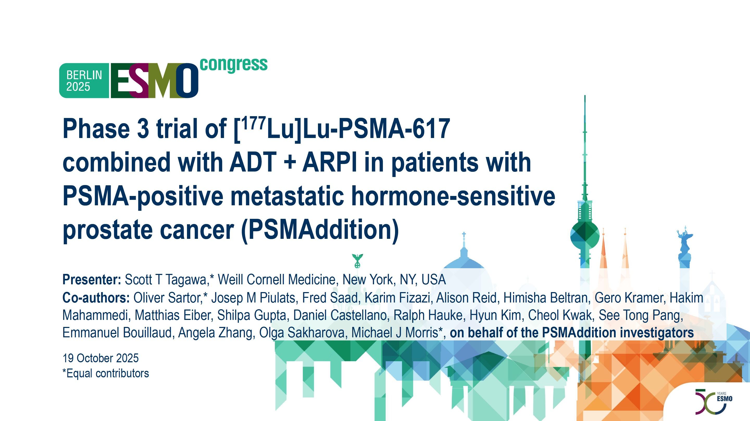
Abstract LBA6

Slide 72
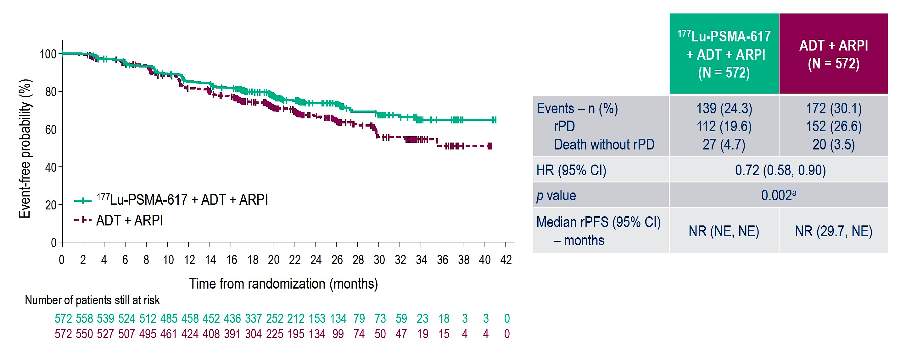
Phase III PSMAddition: Radiographic Progression-Free Survival by BIRC
Tagawa ST et al. ESMO 2025;Abstract LBA6.

Slide 73
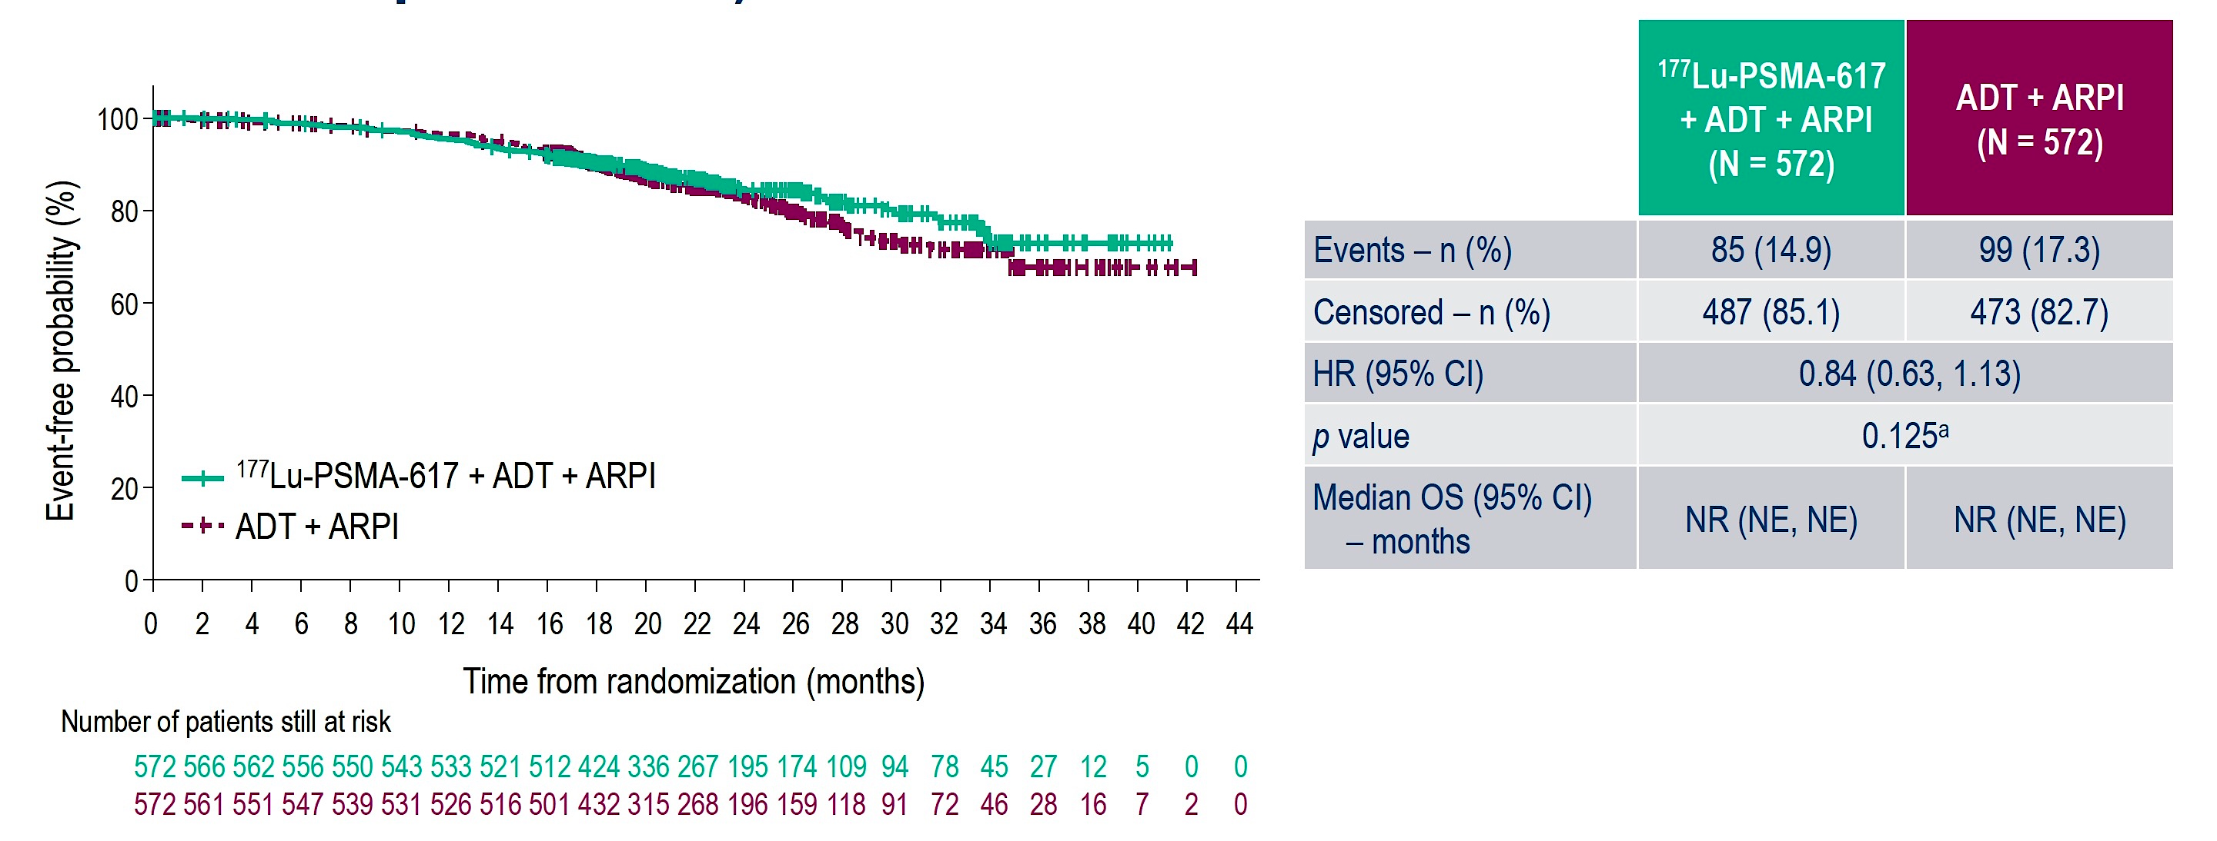
Phase III PSMAddition: Interim Overall Survival (OS)
Tagawa ST et al. ESMO 2025;Abstract LBA6.

Slide 74
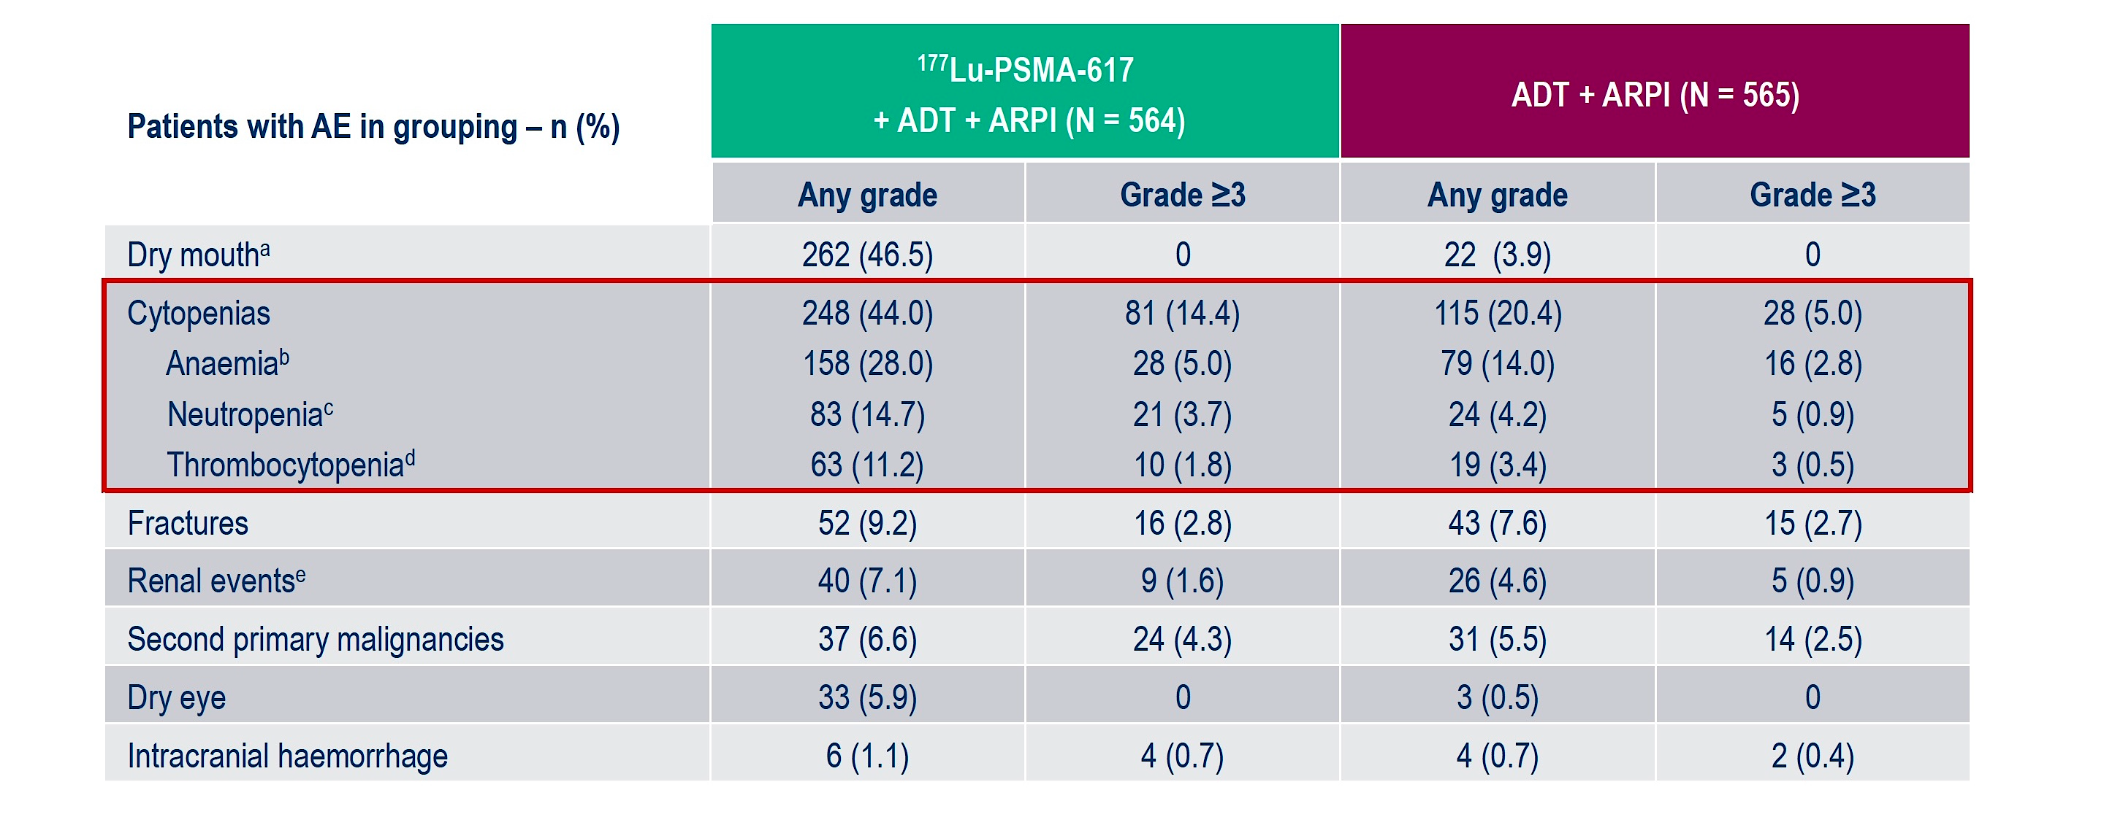
Phase III PSMAddition: Adverse Events (AEs) of Special Interest
Tagawa ST et al. ESMO 2025;Abstract LBA6.

Slide 75
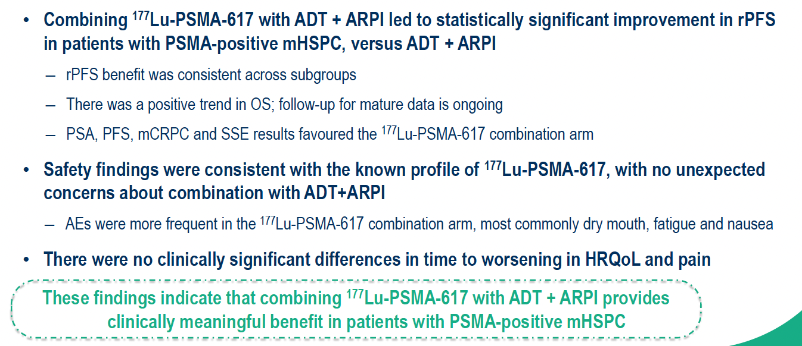
Phase III PSMAddition: Authors’ Conclusions
Tagawa ST et al. ESMO 2025;Abstract LBA6.

Slide 76
Dr McKay: Case Presentation
Patient: 72-year-old male
Clinical Course:
De novo metastatic disease diagnosed March 2025: Gleason 5+4=9, PSA 156 ng/mL
Bone metastases in spine and pelvis, no visceral disease
Some minimal bony pain in lower back
PSMA PET/CT showed high PSMA expression in all metastatic lesions
Started ADT + abiraterone 1000 mg daily with prednisone in April 2025
Based on PSMAddition trial approach, also initiated [177Lu]Lu-PSMA-617 in May 2025
PSA dropped to <0.2 by 6 months. Received all 6 doses of treatment.
Developed fatigue and dry mouth but well managed

Slide 77
Radiation Therapy and ADT with or without an ARPI
Nguyen P et al. Randomised phase III trial of androgen deprivation therapy (ADT) with radiation therapy with or without enzalutamide for high risk, clinically localised prostate cancer: ENZARAD (ANZUP 1303). ESMO 2025;Abstract LBA86.

Slide 78
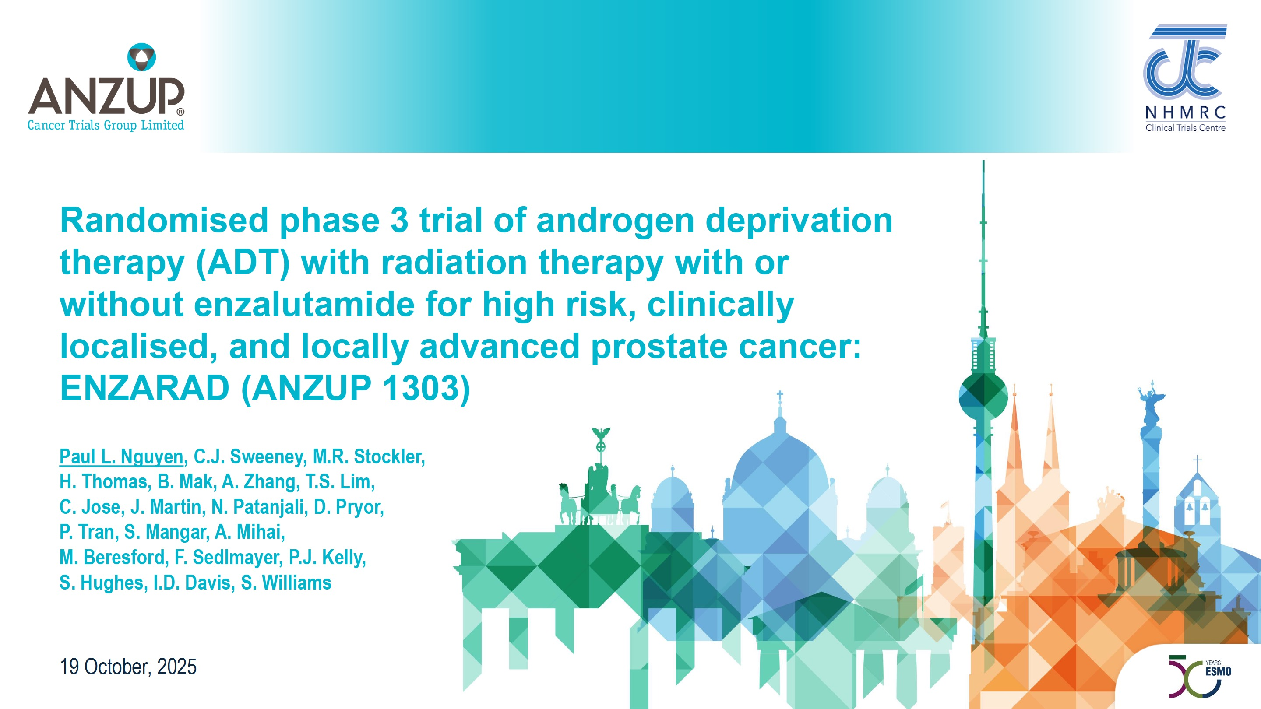
Abstract LBA86

Slide 79
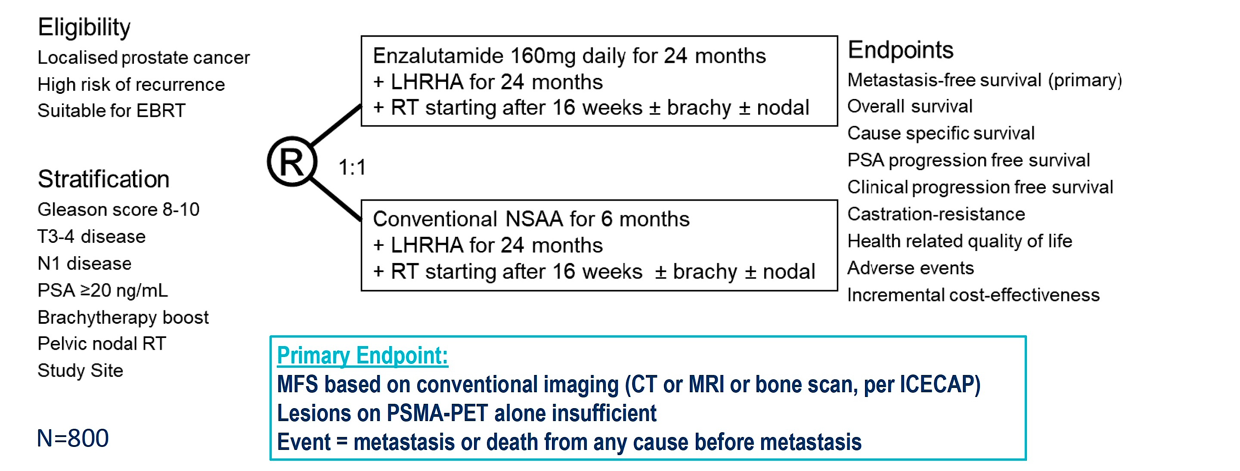
Phase III ENZARAD Study Design
Nguyen PL et al. ESMO 2025;Abstract LBA86.

Slide 80
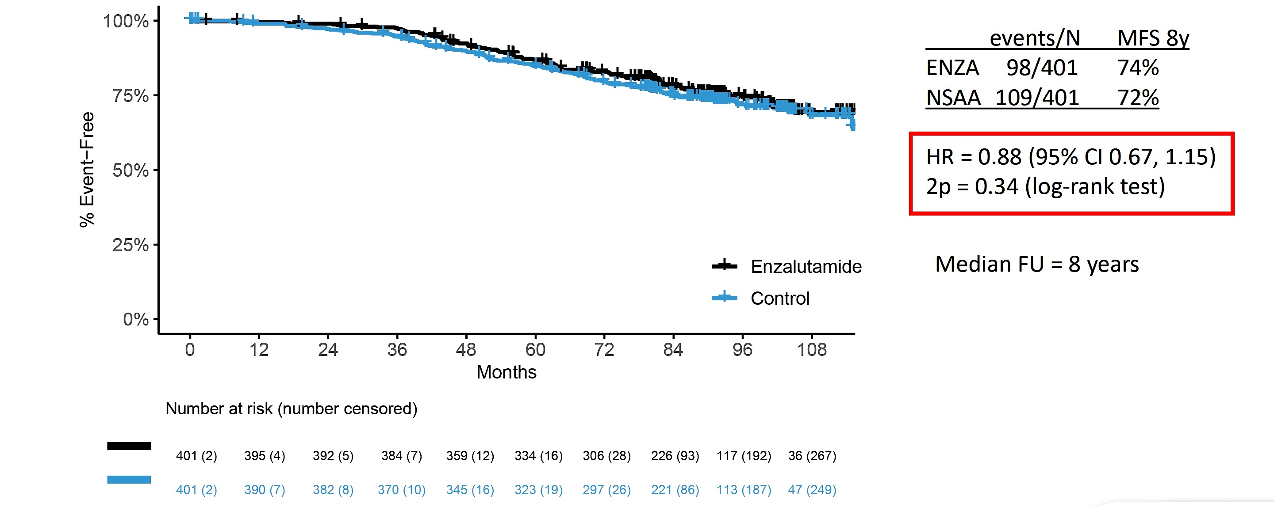
Phase III ENZARAD Primary Endpoint: MFS by Conventional Imaging
Nguyen PL et al. ESMO 2025;Abstract LBA86.

Slide 81
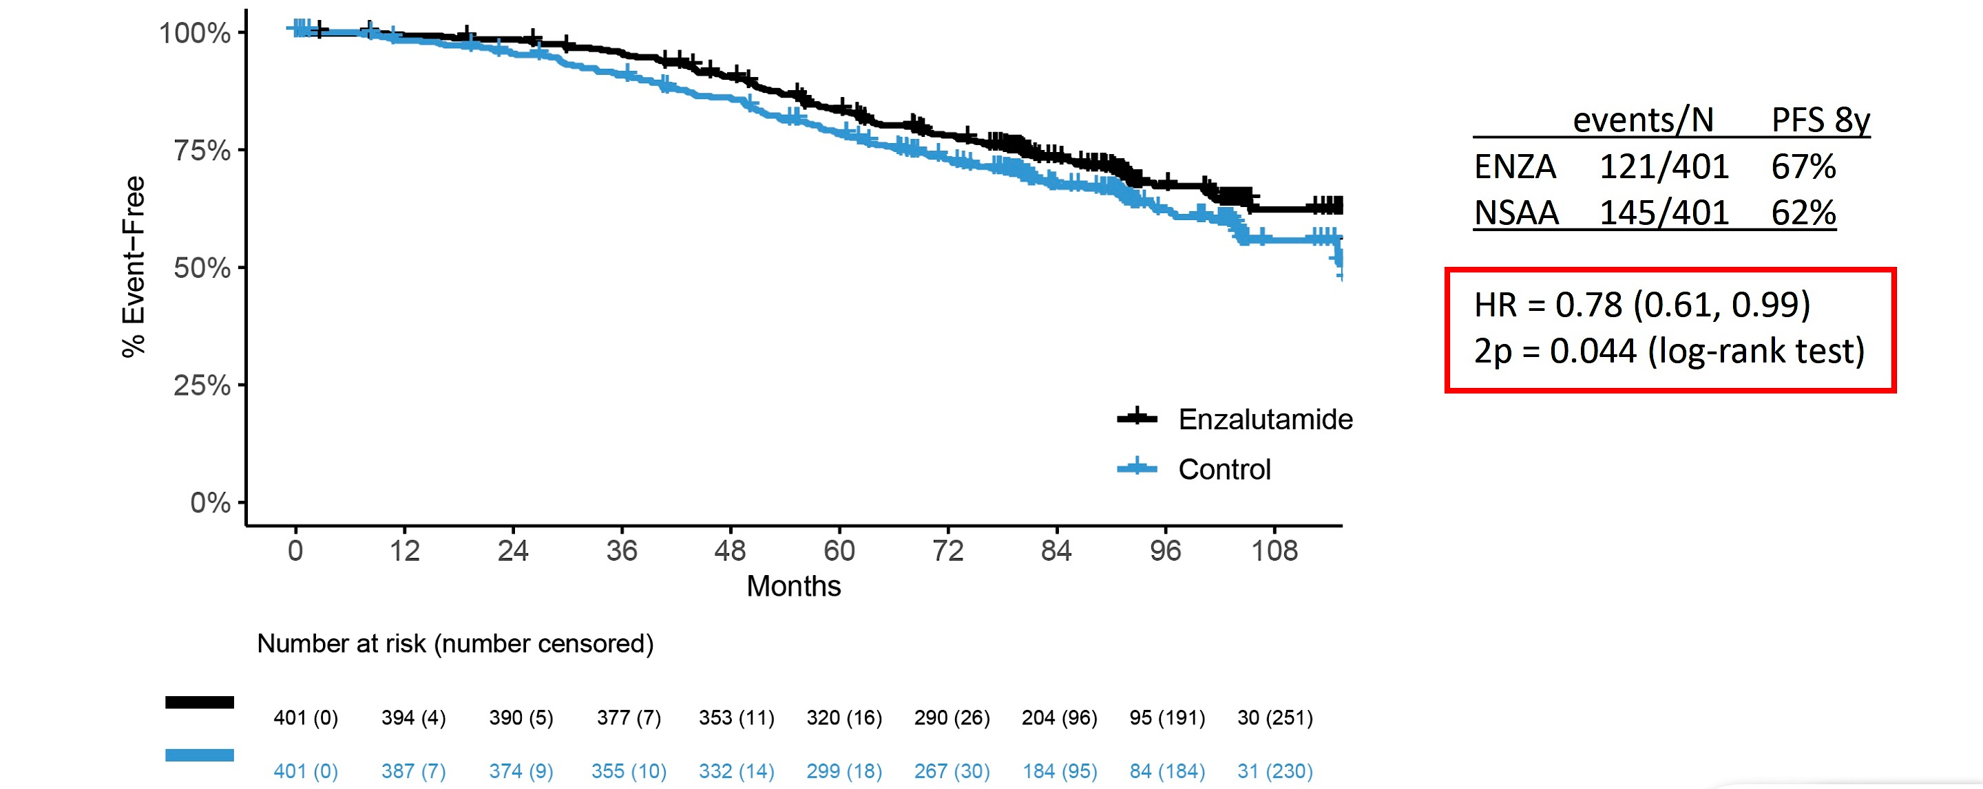
Phase III ENZARAD: PSA Progression-Free Survival
Nguyen PL et al. ESMO 2025;Abstract LBA86.

Slide 82
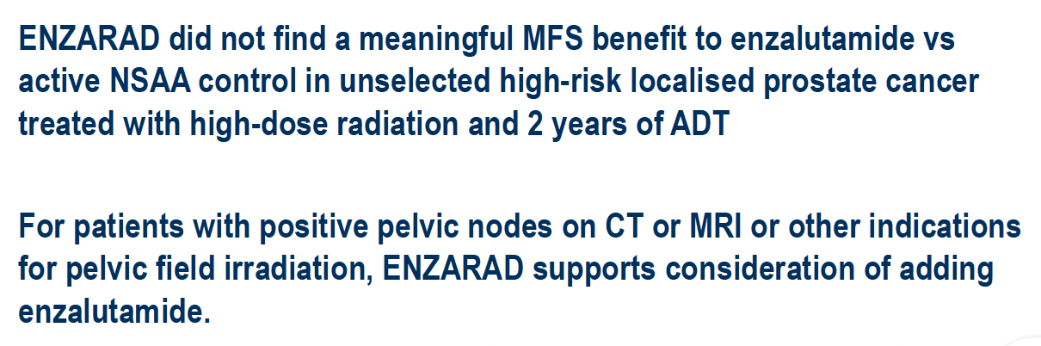
Phase III ENZARAD: Authors’ Conclusions
Nguyen PL et al. ESMO 2025;Abstract LBA86.

Slide 83
Agenda
Module 1: Prostate Cancer
Capivasertib for Metastatic Hormone-Sensitive Prostate Cancer (mHSPC)
PARP Inhibitors and Androgen Receptor Pathway Inhibitors (ARPIs) for Metastatic Prostate Cancer
Biochemically Recurrent Prostate Cancer
Lutetium Lu 177 Vipivotide Tetraxetan for mHSPC
Radiation Therapy and Androgen Deprivation Therapy with or without an ARPI
Module 2: Urothelial Bladder Cancer
Neoadjuvant and Perioperative Treatment Approaches for Muscle Invasive Bladder Cancer (MIBC)
Circulating Tumor DNA and Adjuvant Immunotherapy for MIBC
HER2-Targeted Antibody-Drug Conjugates for Metastatic Urothelial Bladder Cancer (mUBC)
Targeting TROP2 in mUBC
Immunotherapy and BCG for Non-Muscle-Invasive Bladder Cancer

Slide 84
Key Datasets in Bladder Cancer
De Santis M et al. Durvalumab (D) in combination with bacillus Calmette-Guérin (BCG) for BCG-naïve, high-risk non-muscle-invasive bladder cancer (NMIBC): Final analysis of the phase III, open-label, randomised POTOMAC trial. ESMO 2025;Abstract LBA108.
Vulsteke C et al. Perioperative (periop) enfortumab vedotin (EV) plus pembrolizumab (pembro) in participants (pts) with muscle-invasive bladder cancer (MIBC) who are cisplatin-ineligible: The phase III KEYNOTE-905 study. ESMO 2025;Abstract LBA2.
van der Heijden M et al. Health-related quality of life (HRQoL) outcomes from the NIAGARA trial of perioperative durvalumab (D) plus neoadjuvant chemotherapy (NAC) in muscle-invasive bladder cancer (MIBC). ESMO 2025;Abstract 3069MO.
Necchi A et al. Neoadjuvant gemcitabine intravesical system (TAR-200) + cetrelimab (CET) or CET alone in patients (pts) with muscle-invasive bladder cancer (MIBC): SunRISe-4 (SR-4) primary analysis and biomarker results. ESMO 2025;Abstract LBA112.
Powles T et al. IMvigor011: A phase III trial of circulating tumour (ct)DNA-guided adjuvant atezolizumab vs placebo in muscle-invasive bladder cancer. ESMO 2025;Abstract LBA8.

Slide 85
Key Datasets in Bladder Cancer (Continued)
Galsky MD et al. Adjuvant nivolumab vs placebo for high-risk muscle-invasive urothelial carcinoma: 5-year efficacy and ctDNA results from CheckMate 274. ESMO 2025;Abstract 3068O.
Guo J et al. Disitamab vedotin (DV) plus toripalimab (T) versus chemotherapy (C) in first-line (1L) locally advanced or metastatic urothelial carcinoma (la/mUC) with HER2-expression. ESMO 2025;Abstract LBA7.
Makker V et al. Trastuzumab deruxtecan (T-DXd) for pretreated patients (pts) with HER2-expressing solid tumors: DESTINY-PanTumor02 (DP-02) part 1 final analysis. ESMO 2025;Abstract 957P.
Rha SY et al. Datopotamab deruxtecan (Dato-DXd) + rilvegostomig (rilve) in patients (pts) with locally advanced or metastatic urothelial cancer (a/mUC): Results from the phase II TROPION-PanTumor03 study. ESMO 2025;Abstract 3072MO.

Slide 86
Neoadjuvant and Perioperative Treatment Approaches for MIBC
Vulsteke C et al. Perioperative (periop) enfortumab vedotin (EV) plus pembrolizumab (pembro) in participants (pts) with muscle-invasive bladder cancer (MIBC) who are cisplatin-ineligible: The phase III KEYNOTE-905 study. ESMO 2025;Abstract LBA2.
van der Heijden M et al. Health-related quality of life (HRQoL) outcomes from the NIAGARA trial of perioperative durvalumab (D) plus neoadjuvant chemotherapy (NAC) in muscle-invasive bladder cancer (MIBC). ESMO 2025;Abstract 3069MO.
Necchi A et al. Neoadjuvant gemcitabine intravesical system (TAR-200) + cetrelimab (CET) or CET alone in patients (pts) with muscle-invasive bladder cancer (MIBC): SunRISe-4 (SR-4) primary analysis and biomarker results. ESMO 2025;Abstract LBA112.

Slide 87
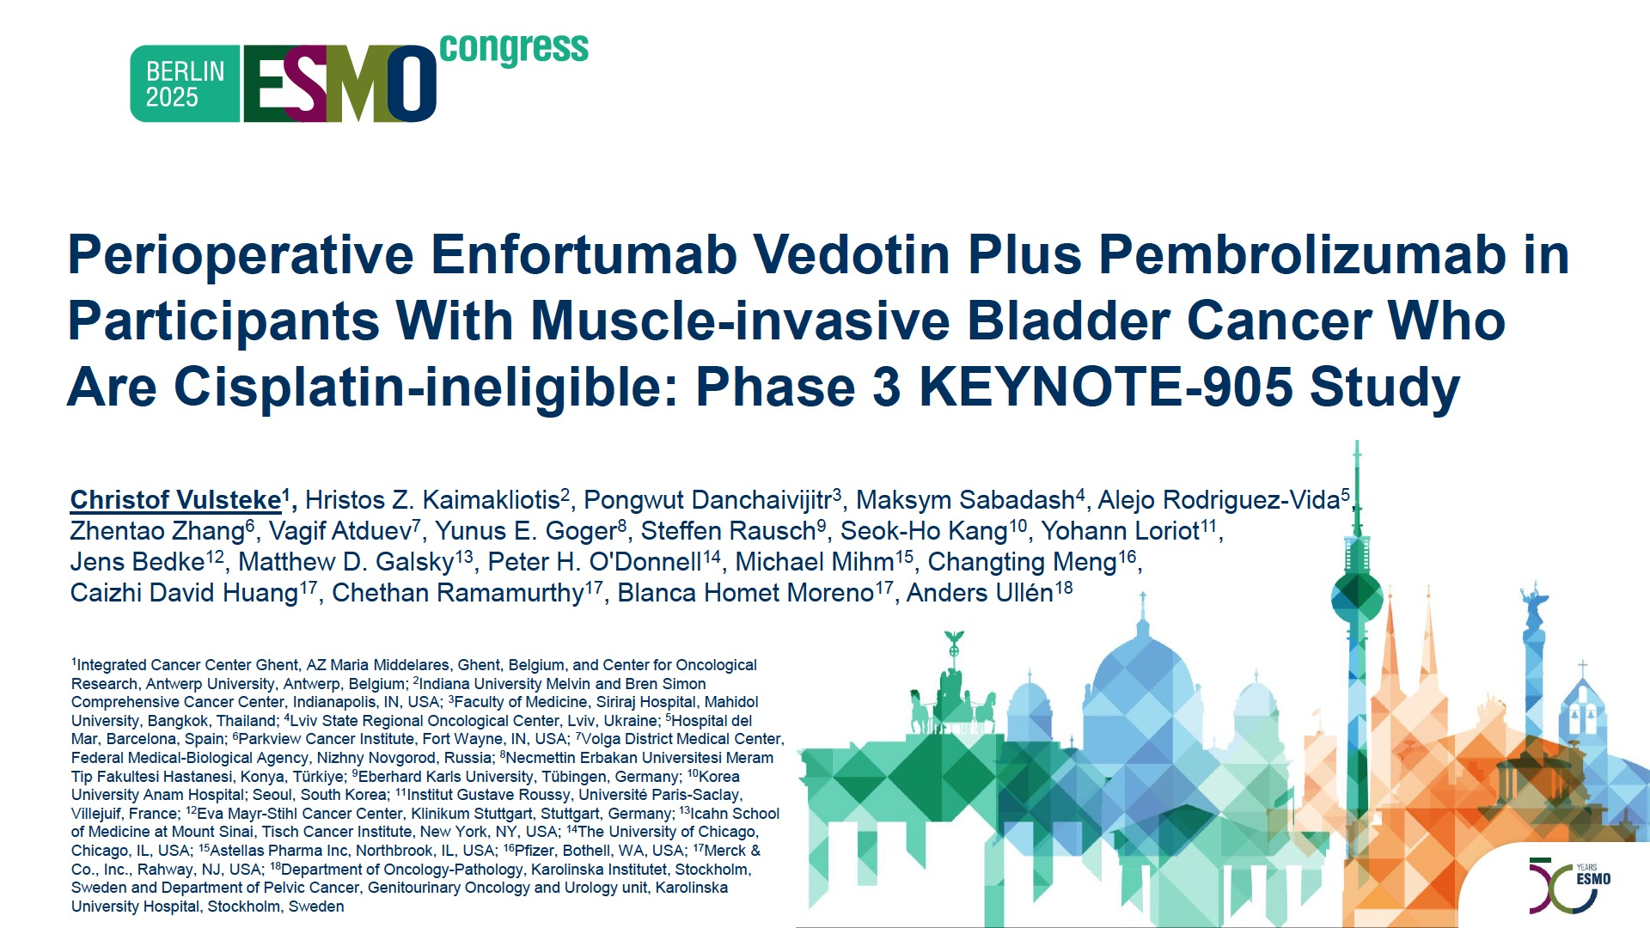
Abstract LBA2

Slide 88
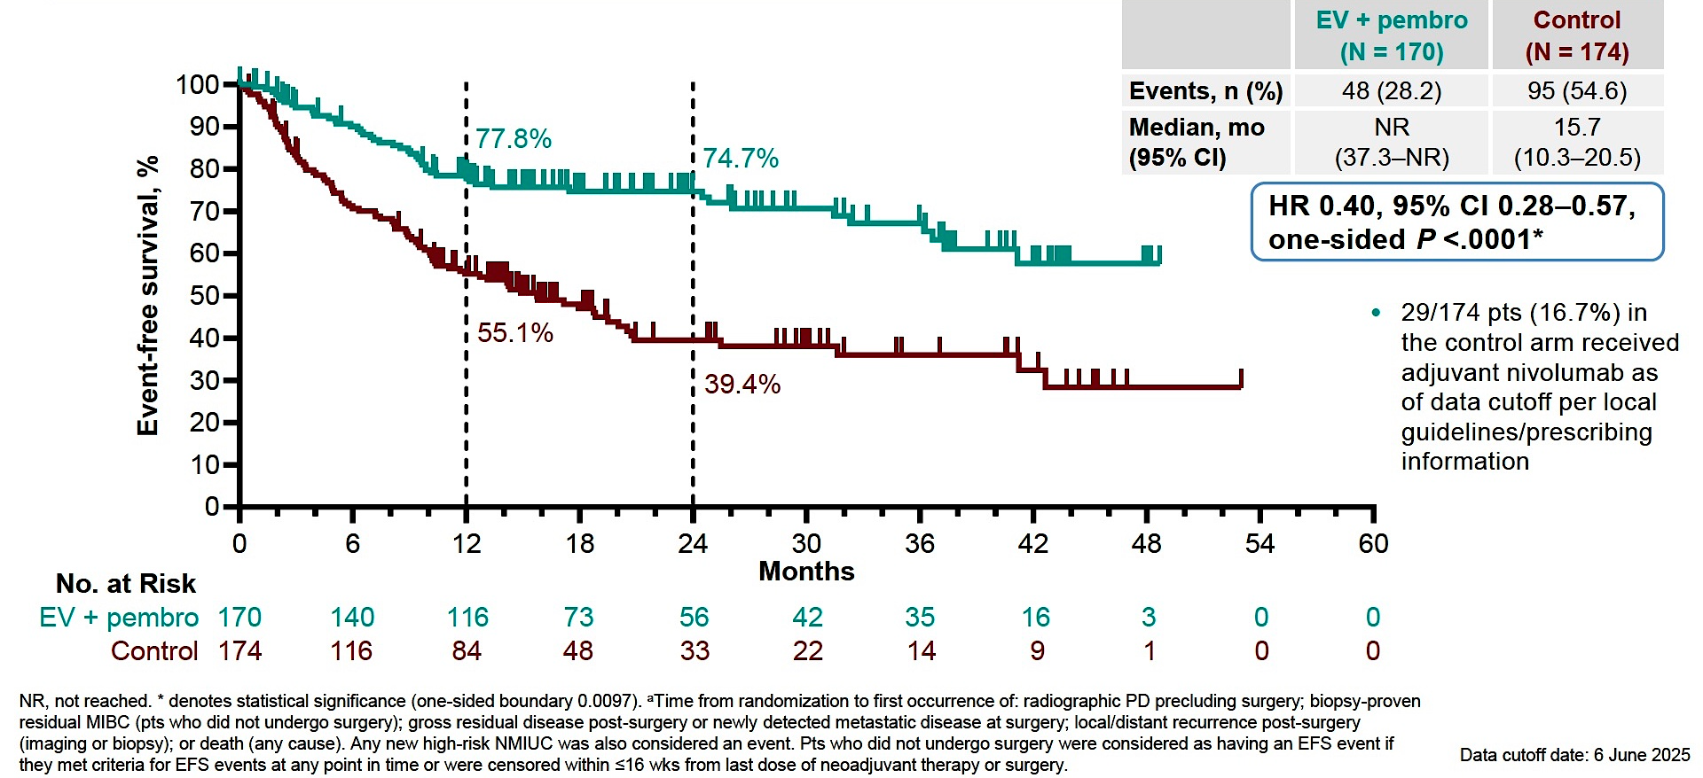
Phase III KEYNOTE-905: Event-Free Survival in the Intent-to-Treat Population by Blinded Independent Central Review
Vulsteke C et al. ESMO 2025;Abstract LBA2.

Slide 89
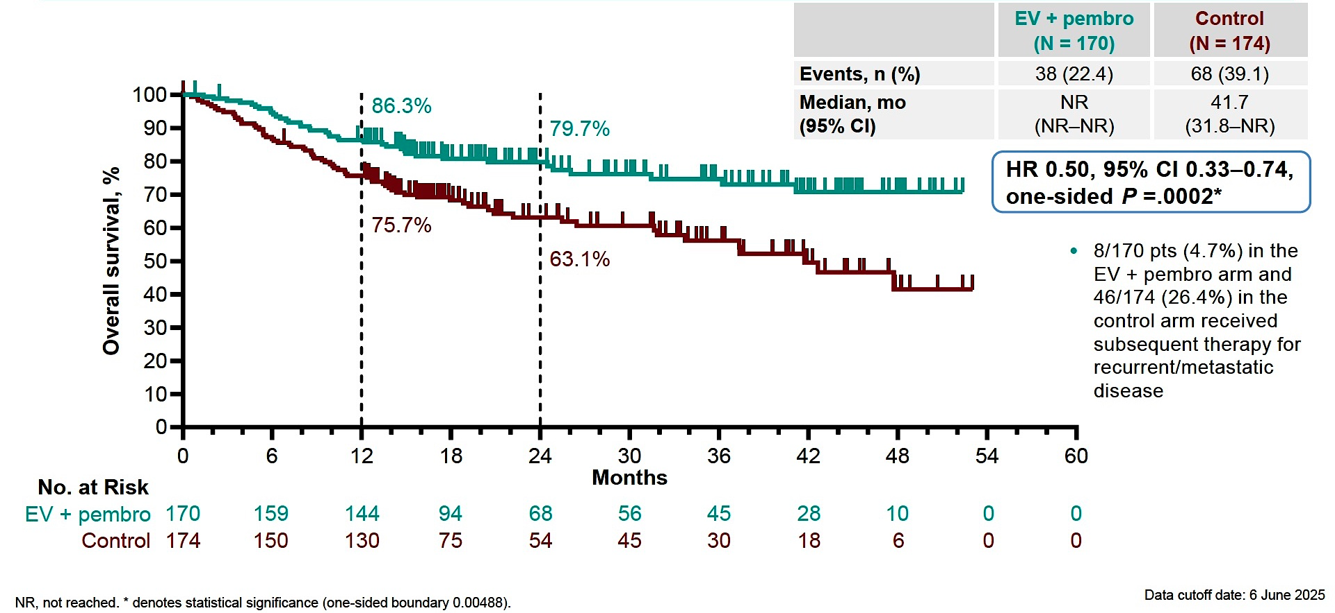
Phase III KEYNOTE-905: Overall Survival
Vulsteke C et al. ESMO 2025;Abstract LBA2.

Slide 90
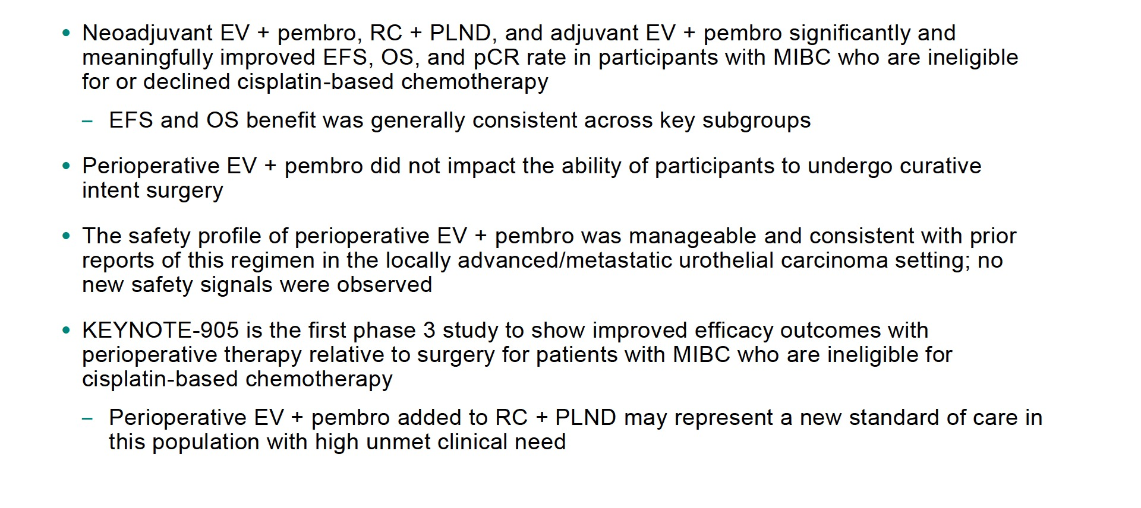
Phase III KEYNOTE-905: Authors’ Conclusions
RC = radical cystectomy; PLND = pelvic lymph node dissection
Vulsteke C et al. ESMO 2025;Abstract LBA2.

Slide 91
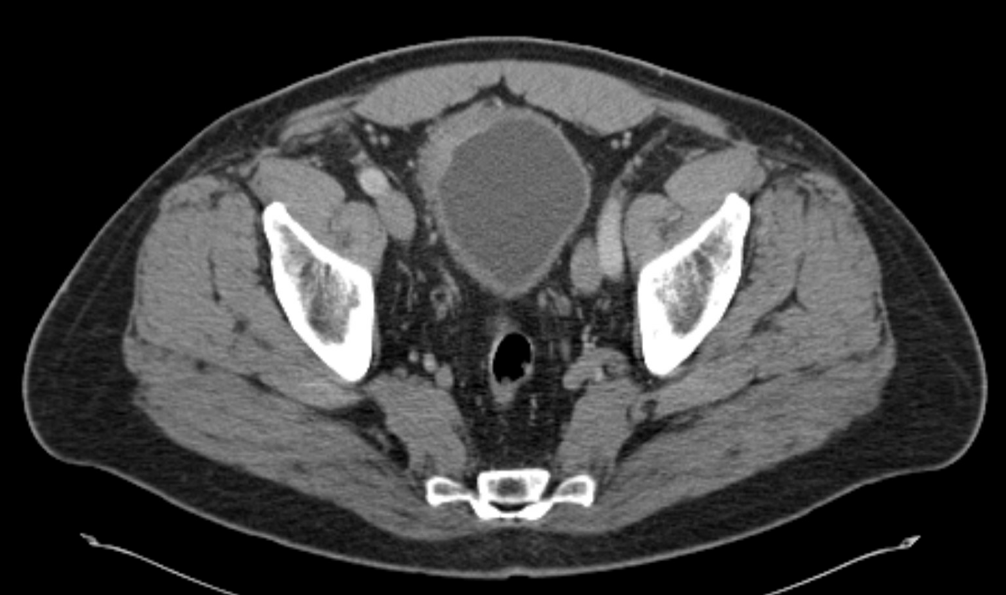
Dr Friedlander: Case Presentation
66 y.o. M with HTN and hyperlipidemia with new onset hematuria
CT Urogram: lobulated mass along the right anterolateral bladder wall measuring 2.6 x 2.9 x 2.7 cm, irregular wall thickening. R
  R pelvis 1.3cm suspicious for metastasis.
  CT chest negative
  TURBT: 5cm tumor at R dome of the bladder.
    Path: Muscle-invasive papillary urothelial carcinoma, high-grade with sarcomatoid (5%) and micropapillary (5%) subtype morphology and glandular differentiation (<5%)
  Cr 1.45

Slide 92
Dr Friedlander: Case Presentation (Continued)
Met with medical oncology. Discussed low likelihood of cure with cisplatin-based chemotherapy and surgery.
  “Isn’t there anything better?”
Mid 2024: Starts 4 cycles of EV + Pembrolizumab
  Course c/b pruritus, grade 2 rash responsive to topical steroids, fatigue, and slowly increasing peripheral neuropathy.
Undergoes radical cystectomy with ileal conduit.
  Pathology: ypT0N0, 0/25 LNs complete response!

Slide 93
Dr Friedlander: Case Presentation (Continued)
Post-op
  What is the role of more therapy?
    Discussion of the ongoing KN-B15/EV-304 and KN-905/EV-303 trials
    ctDNA negative
  Starts adjuvant EV + P for 5 more cycles
    Course c/b by fatigue, cough, pruritic, dry eye, blisters at ostomy site
  Remains in remission (?cured?), however intermittent fevers due to either recurrent infection or autoimmune phenomenon, still not clear.

Slide 94
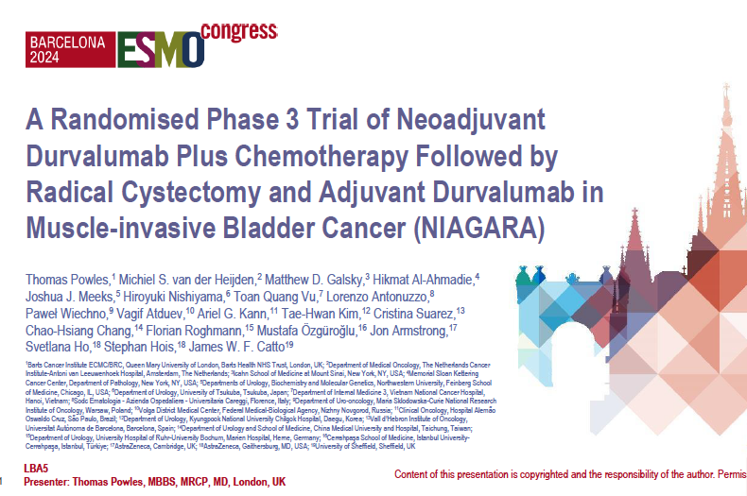
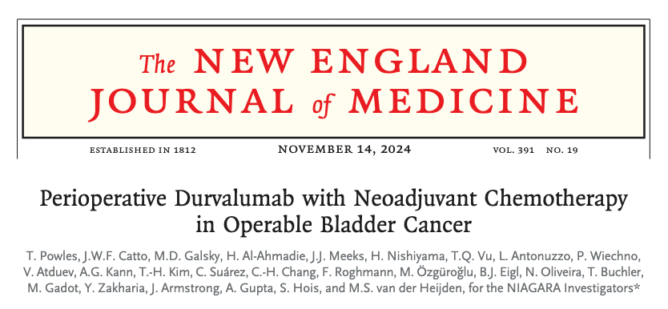

Slide 95
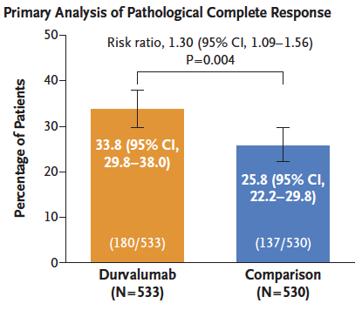
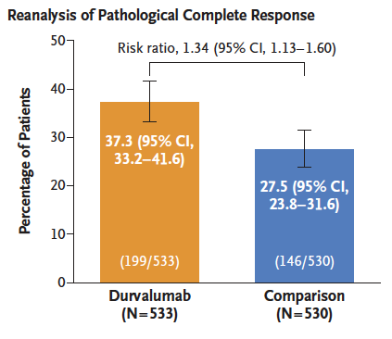
NIAGARA: Pathologic Complete Response with Perioperative Durvalumab and Neoadjuvant Chemotherapy
Powles T et al. ESMO 2024;Abstract LBA5; Powles T et al. N Engl J Med 2024;391(19):1773-86.

Slide 96
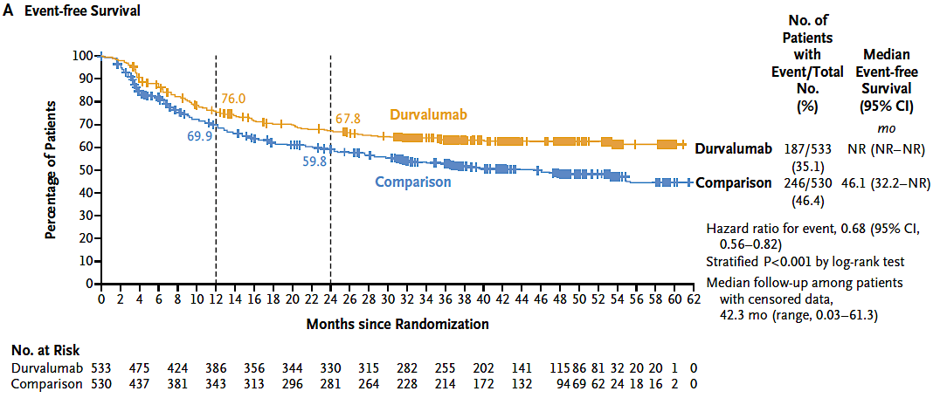
NIAGARA: Event-Free Survival with Perioperative Durvalumab and Neoadjuvant Chemotherapy
Powles T et al. ESMO 2024;Abstract LBA5; Powles T et al. N Engl J Med 2024;391(19):1773-86.

Slide 97
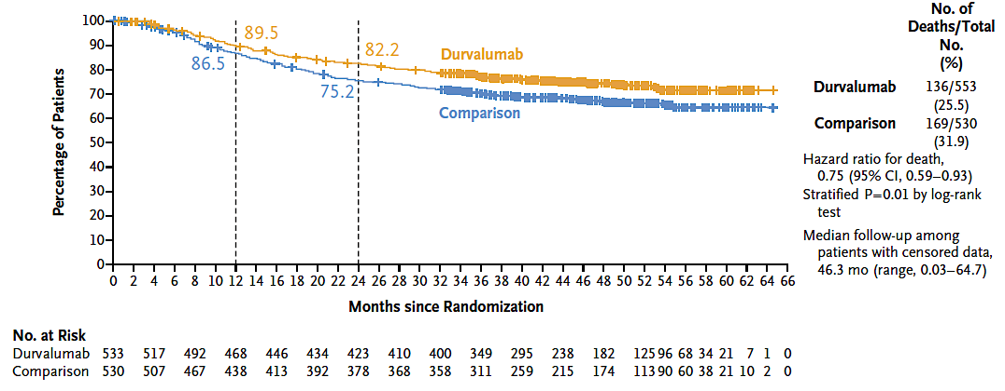
NIAGARA: Overall Survival with Perioperative Durvalumab and Neoadjuvant Chemotherapy
Powles T et al. ESMO 2024;Abstract LBA5; Powles T et al. N Engl J Med 2024;391(19):1773-86.

Slide 98

Phase III NIAGARA: Authors’ Conclusions
Powles T et al. ESMO 2024;Abstract LBA5.

Slide 99

Abstract 3069MO

Slide 100

Phase III NIAGARA: EORTC QLQ-C30 Change from Baseline
EORTC QLQ-C30 = European Organisation for Research and Treatment of Cancer Core Quality of Life questionnaire
van der Heijden M et al. ESMO 2025;Abstract 3069MO.

Slide 101

Phase III NIAGARA: EORTC QLQ-C30 Change from Baseline (Continued)
van der Heijden M et al. ESMO 2025;Abstract 3069MO.

Slide 102

Phase III NIAGARA: Authors’ Conclusions
van der Heijden M et al. ESMO 2025;Abstract 3069MO.

Slide 103
Dr Friedlander: Case Presentation
61 y.o. woman with chronic eczema on dupilumab (anti-IL-4/IL-13) presented with renal colic, found to have R-sided hydroureteronephrosis.
1/2025: ureteroscopy: tumor around the right ureteral orifice. No upper tract disease.
  Pathology: high grade urothelial carcinoma, with extensive muscularis mucosae invasion, LVI+.
CT urogram: Irregular wall thickening at the R uretero-vesicular junction. No metastatic disease in the abdomen/pelvis.

Slide 104
Dr Friedlander: Case Presentation (Continued)
Not a good candidate for chemoRT due to hydronephrosis.
Pt elects for neoadjuvant therapy followed by cystectomy.
Long discussion with dermatology about risks of eczema exacerbation
Feb 2025: Starts 4 cycles of cisplatin 70mg/m2 + gemcitabine 1000mg/m2 + durvalumab 1500mg (NIAGARA regimen)
Course c/b the following
  Cis/gem: fatigue, mild renal dysfunction, nausea
  Durvalumab: grade 2 psoriatic plaque over chest and arm improved with topical steroids. No eczema exacerbation.
Notes:
\

Slide 105
Dr Friedlander: Case Presentation (Continued)
Tolerates 4 cycles of therapy then radical cystectomy with neobladder
Pathology: High grade UC invasive into the muscularis mucosae and perivesical adipose tissue, 0/16 LN, pT3N0. Post-op ctDNA undetetcable
June 2025: What to do?
  Continue Durvalumab?
  Switch to EV + P?
  Surveillance?
Pt elects to continue durvalumab, ctDNA remains negative as of now
  Psoriasis controlled with topical steroids
  Working with dermatology to consider steroid sparing alternatives

Slide 106

Abstract LBA112

Slide 107

Phase II SunRISe-4: Pathologic Complete Response Rates and Recurrence-Free Survival
Necchi A et al. ESMO 2025;Abstract LBA112.

Slide 108

Phase II SunRISe-4: Authors’ Conclusions
Necchi A et al. ESMO 2025;Abstract LBA112.

Slide 109
Circulating Tumor DNA and Adjuvant Immunotherapy for MIBC
Powles T et al. IMvigor011: A phase III trial of circulating tumour (ct)DNA-guided adjuvant atezolizumab vs placebo in muscle-invasive bladder cancer. ESMO 2025;Abstract LBA8.
Galsky MD et al. Adjuvant nivolumab vs placebo for high-risk muscle-invasive urothelial carcinoma: 5-year efficacy and ctDNA results from CheckMate 274. ESMO 2025;Abstract 3068O.

Slide 110

Abstract LBA8

Slide 111

Phase III IMvigor011: Investigator-Assessed Disease-Free Survival for Patients Whose Disease Tested ctDNA Positive
Powles T et al. ESMO 2025;Abstract LBA8.

Slide 112

Phase III IMvigor011: OS for Patients Whose Disease Tested ctDNA Positive
Powles T et al. ESMO 2025;Abstract LBA8.

Slide 113

Phase III IMvigor011: Disease-Free Survival (DFS) and OS for Patients Whose Disease Tested ctDNA Positive
Powles T et al. ESMO 2025;Abstract LBA8.

Slide 114

Phase III IMvigor011: Authors’ Conclusions
MRD = molecular residual disease
Powles T et al. ESMO 2025;Abstract LBA8.

Slide 115

Abstract 3068O

Slide 116

Phase III CheckMate 274: Disease-Free Survival for All Randomly Assigned Patients and Patients with PD-L1 ≥1%
Galsky MD et al. ESMO 2025;Abstract 3068O.

Slide 117

Phase III CheckMate 274: Interim Overall Survival for All Randomly Assigned Patients and Patients with PD-L1 ≥1%
Galsky MD et al. ESMO 2025;Abstract 3068O.

Slide 118

Correlation of ctDNA Status with DFS and OS
Galsky MD et al. ESMO 2025;Abstract 3068O.

Slide 119

Phase III CheckMate 274: Authors’ Conclusions
Nivolumab/hyaluronidase [package
Nivolumab [summary of product characteristics].
Galsky MD et al. ESMO 2025;Abstract 3068O.

Slide 120
Dr Friedlander: Case Presentation
62 yo M with long tobacco history, HTN, presents with hematuria. Workup shows high grade pT1 NMIBC
  June-Nov 2024: Receives BCG induction and maintenance
12/2024: Cysto with new posterior wall nodule
Feb 2025: TURBT: HG T1 UC, +lymphovascular invasion (+LVI), no muscle invasion
cfDNA (Signatera™) negative

Slide 121


Slide 122
Dr Friedlander: Case Presentation (Continued)
Tumor board: Pt at high risk for progression to MIBC/metastases given
  No response to BCG
  +LVI
April 2025: Discussed role of neoadjuvant systemic therapy vs RC vs RT
  “I am really active, love to travel, hoping to avoid side effects”
  cfDNA now positive: 0.05 mean tumor molecules (MTM)/ml
Pt elects for RC alone, hoping no systemic therapy will be needed

Slide 123
Dr Friedlander: Case Presentation (Continued)
RC with neobladder
  Path: pT3bN2, 3/12 LNs+, HER2 3+. Left ureteral soft tissue margin+.
  Also Gl 3+4, pT2N0 prostate cancer
  Post op course c/b pelvic fluid collection requiring drain
1st post op visit: cfDNA negative!
  Pt encouraged, but high concern for relapse. Still recovering from surgery.
2nd post op visit: cfDNA now positive 2.2 MTM/ml
  “Sounds like I should get some chemo or immunotherapy?”
Summer 2025: Starts cisplatin + gemcitabine + durvalumab

Slide 124

Dr Friedlander: Case Presentation (Continued)
Surgery
Adjuvant Cis/Gem/Durva

Slide 125
HER2-Targeted Antibody-Drug Conjugates for Metastatic Urothelial Carcinoma
Guo J et al. Disitamab vedotin (DV) plus toripalimab (T) versus chemotherapy (C) in first-line (1L) locally advanced or metastatic urothelial carcinoma (la/mUC) with HER2-expression. ESMO 2025;Abstract LBA7.
Makker V et al. Trastuzumab deruxtecan (T-DXd) for pretreated patients (pts) with HER2-expressing solid tumors: DESTINY-PanTumor02 (DP-02) part 1 final analysis. ESMO 2025;Abstract 957P.

Slide 126

Abstract LBA7

Slide 127

Phase III RC48-C016: PFS by BIRC
Guo J et al. ESMO 2025;Abstract LBA7.

Slide 128

Phase III RC48-C016: Overall Survival
Guo J et al. ESMO 2025;Abstract LBA7.

Slide 129

Phase III RC48-C016: Duration of Response
Guo J et al. ESMO 2025;Abstract LBA7.

Slide 130

Phase III RC48-C016: Authors’ Conclusions
Guo J et al. ESMO 2025;Abstract LBA7.

Slide 131

Abstract 957P

Slide 132

Phase II DESTINY-PanTumor02 Study Design
Makker V et al. ESMO 2025;Abstract 957P.

Slide 133

Phase II DESTINY-PanTumor02 Part 1 Final Analysis: Investigator-Assessed Confirmed ORR by Tumor Cohort and HER2 IHC
Makker V et al. ESMO 2025;Abstract 957P.

Slide 134

Phase II DESTINY-PanTumor02 Part 1 Final Analysis:
Median PFS by Tumor Cohort and HER2 IHC
Makker V et al. ESMO 2025;Abstract 957P.

Slide 135

Phase II DESTINY-PanTumor02 Part 1 Final Analysis:
Median OS by Tumor Cohort and HER2 IHC
Makker V et al. ESMO 2025;Abstract 957P.

Slide 136

Phase II DESTINY-PanTumor02 Part 1 Final Analysis:
Authors’ Conclusions
Makker V et al. ESMO 2025;Abstract 957P.

Slide 137
Dr Friedlander: Case Presentation
72 yo F with HTN, alcohol use disorder, GERD presents with MIBC in 2023
  S/p 4 cycles of cisplatin/gemcitabine then RC with ileal conduit
  Pathology: ypT4aN2Mx, 8/24 LNs +, 2.2cm residual tumor, plasmacytoid histology. HER2 3+
Receives 6 months of adjuvant nivolumab
  Mid 2024: CT with pelvic nodal and vertebral metastases
Starts EV + P x 3 cycles, complicated by steroid-responsive pneumonitis thought related to EV
Notes:
For each case, we would like a brief write-up that includes the patient’s age/sex, clinical course (including prior treatments received, current treatment and current status) and any other details that you find relevant and/or interesting. Relevant imaging or labs are appreciated if available. In general, we prefer less complicated cases focusing on common treatment scenarios. If you do not have a real case matching the criteria requested, you may provide an adapted or theoretical case in which you would consider the strategy in question.
Please provide at your earliest convenience, or by Friday, November 14, 2025.
Dr Friedlander
A patient with MIBC who received perioperative durvalumab
A patient with MIBC who received perioperative enfortumab vedotin/pembrolizumab - GMcB
A patient with MIBC for whom ctDNA testing was used to guide treatment decision-making DS
A patient with HER2-positive mUBC who received trastuzumab deruxtecan SK

Slide 138
Dr Friedlander: Case Presentation (Continued)
Fall 2024: SBRT to all sites of cancer
Early 2025: New nodal and vertebral disease.
  Starts Trastuzumab deruxtecan (T-DXd)
  Course c/b mild nausea, alternating constipation and diarrhea 10lb wt loss, loss of taste (progressive), mild malaise 1 week post each infusion, group B strep sepsis despite GCSF
CT scan after 4 cycles: Stable disease
CT scan after 6 cycles: Slightly decreased lymphadenopathy, no new lesions
October 2025: CT scan after 8 cycles with new lung and liver nodules
  Screening for FX-909 (PPARG inhibitor) clinical trial at UCSF

Slide 139
Targeting TROP2 in mUC
Rha SY et al. Datopotamab deruxtecan (Dato-DXd) + rilvegostomig (rilve) in patients (pts) with locally advanced or metastatic urothelial cancer (a/mUC): Results from the phase II TROPION-PanTumor03 study. ESMO 2025;Abstract 3072MO.

Slide 140

Abstract 3072MO

Slide 141

Phase II TROPION-PanTumor03: Investigator-Asssessed Objective Response Rate, Duration of Response
Rha SY et al. ESMO 2025;Abstract 3072MO.

Slide 142

Phase II TROPION-PanTumor03: Overall Safety Summary
Rha SY et al. ESMO 2025;Abstract 3072MO.

Slide 143

Phase II TROPION-PanTumor03: Authors’ Conclusions
Rha SY et al. ESMO 2025;Abstract 3072MO.

Slide 144
Immunotherapy and BCG for NMIBC
De Santis M et al. Durvalumab (D) in combination with bacillus Calmette-Guérin (BCG) for BCG-naïve, high-risk non-muscle-invasive bladder cancer (NMIBC): Final analysis of the phase III, open-label, randomised POTOMAC trial. ESMO 2025;Abstract LBA108.

Slide 145

Abstract LBA108

Slide 146

Phase III POTOMAC: Disease-Free Survival (DFS) with Durvalumab/BCG versus BCG
De Santis M et al. ESMO 2025;Abstract LBA108.

Slide 147

Phase III POTOMAC: Overall Survival with Durvalumab/BCG versus BCG
De Santis M et al. ESMO 2025;Abstract LBA108.

Slide 148

Phase III POTOMAC: Authors’ Conclusions
De Santis M et al. ESMO 2025;Abstract LBA108.

Slide 149
Exciting CME Events You Do Not Want to Miss
A Friday Satellite Symposium Series Preceding the 67th ASH Annual Meeting
Friday, December 5, 2025
Acute Myeloid Leukemia
7:30 AM – 9:30 AM ET
Myelofibrosis and
Systemic Mastocytosis
3:15 PM – 5:15 PM ET
Chronic Lymphocytic Leukemia
11:30 AM – 1:30 PM ET
Follicular Lymphoma and
Diffuse Large B-Cell Lymphoma
7:00 PM – 9:00 PM ET

Slide 150
Thank you for joining us!
Please take a moment to complete the survey currently up on Zoom. Your feedback is very important to us.
The survey will remain open for
5 minutes after the meeting ends.
Information on how to obtain CME, ABIM MOC and ABS credit is provided in the Zoom chat room.
Attendees will also receive an email in 1 to 3 business days with these instructions.

