Slide 1
Cases from the Community: Investigators Discuss Available Research Guiding the Management of Relapsed/Refractory Multiple Myeloma — What Happened at ASH 2025?
A CME/MOC-Accredited Live Webinar
Monday, December 15, 2025
5:00 PM – 6:00 PM ET
Faculty
Sagar Lonial, MD, FACP, FASCO
María-Victoria Mateos, MD, PhD
Moderator
Neil Love, MD

Slide 2
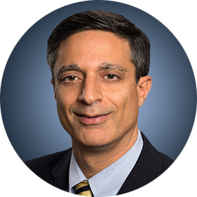
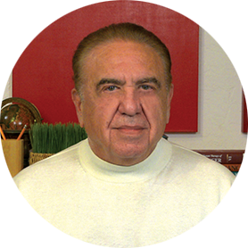
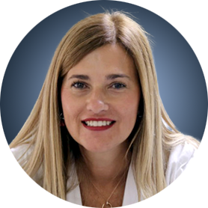
Faculty
Sagar Lonial, MD, FACP, FASCO
Chair and Professor
Department of Hematology and Medical Oncology
Chief Medical Officer
Winship Cancer Institute
Emory University School of Medicine
Atlanta, Georgia
MODERATOR
Neil Love, MD
Research To Practice
Miami, Florida
María-Victoria Mateos, MD, PhD
Consultant Physician in the Haematology Department
Associate Professor of Medicine
Director of the Myeloma Program
Clinical Trials Unit
University Hospital of Salamanca
Salamanca, Spain

Slide 3
Commercial Support
This activity is supported by an educational grant from GSK.

Slide 4
Dr Love — Disclosures
Dr Love is president and CEO of Research To Practice. Research To Practice receives funds in the form of educational grants to develop CME activities from the following companies: Aadi Bioscience, AbbVie Inc, ADC Therapeutics, Agendia Inc, Alexion Pharmaceuticals, Amgen Inc, Array BioPharma Inc, a subsidiary of Pfizer Inc, Arvinas, Astellas, AstraZeneca Pharmaceuticals LP, Aveo Pharmaceuticals, Bayer HealthCare Pharmaceuticals, BeOne, Biotheranostics Inc, A Hologic Company, Black Diamond Therapeutics Inc, Blueprint Medicines, Boehringer Ingelheim Pharmaceuticals Inc, Bristol Myers Squibb, Celcuity, Clovis Oncology, Coherus BioSciences, Corcept Therapeutics Inc, CTI BioPharma, a Sobi Company, Daiichi Sankyo Inc, Eisai Inc, Elevation Oncology Inc, Exact Sciences Corporation, Exelixis Inc, Genentech, a member of the Roche Group, Genmab US Inc, Geron Corporation, Gilead Sciences Inc, GSK, Helsinn Therapeutics (US) Inc, ImmunoGen Inc, Incyte Corporation, Ipsen Biopharmaceuticals Inc, Jazz Pharmaceuticals Inc, Johnson & Johnson, Karyopharm Therapeutics, Kite, A Gilead Company, Kura Oncology, Legend Biotech, Lilly, MEI Pharma Inc, Merck, Mersana Therapeutics Inc, Mirati Therapeutics Inc, Mural Oncology Inc, Natera Inc, Novartis, Novartis Pharmaceuticals Corporation on behalf of Advanced Accelerator Applications, Novocure Inc, Nuvalent, Pfizer Inc, Pharmacyclics LLC, an AbbVie Company, Puma Biotechnology Inc, Regeneron Pharmaceuticals Inc, Rigel Pharmaceuticals Inc, R-Pharm US, Sanofi, Seagen Inc, Servier Pharmaceuticals LLC, SpringWorks Therapeutics Inc, Stemline Therapeutics Inc, Sumitomo Pharma America, Syndax Pharmaceuticals, Taiho Oncology Inc, Takeda Pharmaceuticals USA Inc, TerSera Therapeutics LLC, and Tesaro, A GSK Company.

Slide 5
Research To Practice CME Planning Committee Members,
Staff and Reviewers
Planners, scientific staff and independent reviewers for Research To Practice have no relevant conflicts of interest to disclose.

Slide 6
Dr Lonial — Disclosures
Advisory Committees and Consulting Agreements | AbbVie Inc, Amgen Inc, Bristol Myers Squibb, Genentech, a member of the Roche Group, GSK, Janssen Biotech Inc, Novartis, Pfizer Inc, Regeneron Pharmaceuticals Inc, Takeda Pharmaceuticals USA Inc; Boards of Directors: TG Therapeutics Inc
Contracted Research | Bristol Myers Squibb, Janssen Biotech Inc, Novartis, Takeda Pharmaceuticals USA Inc
Stock Options/Stock — Public Companies | TG Therapeutics Inc

Slide 7
Dr Mateos — Disclosures
Advisory Committees and Speakers Bureaus | Amgen Inc, AstraZeneca Pharmaceuticals LP, Bristol Myers Squibb, GSK, Johnson & Johnson, Kite, A Gilead Company, Menarini Group, Oncopeptides, Pfizer Inc, Regeneron Pharmaceuticals Inc, Sanofi, Stemline Therapeutics Inc

Slide 8
This educational activity contains discussion of
non-FDA-approved uses of agents and regimens. Please refer to official prescribing information for each product for approved indications.

Slide 9
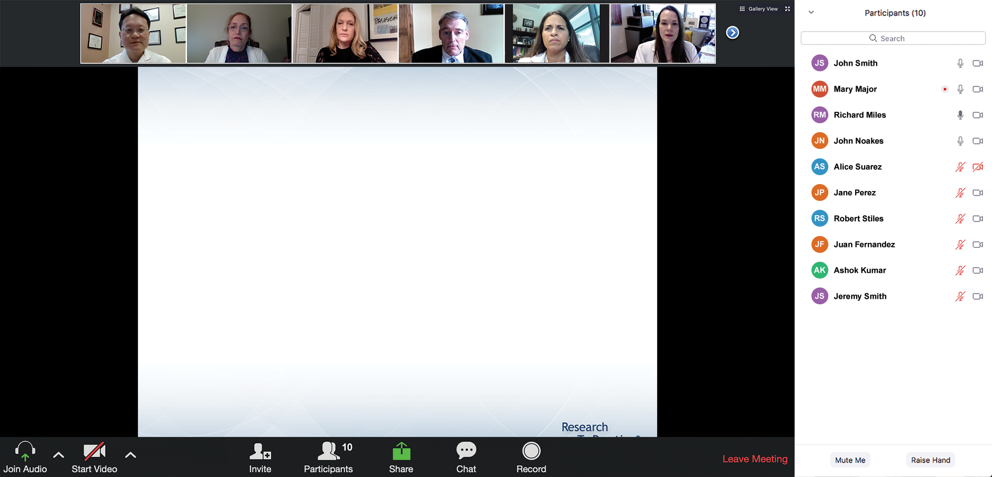
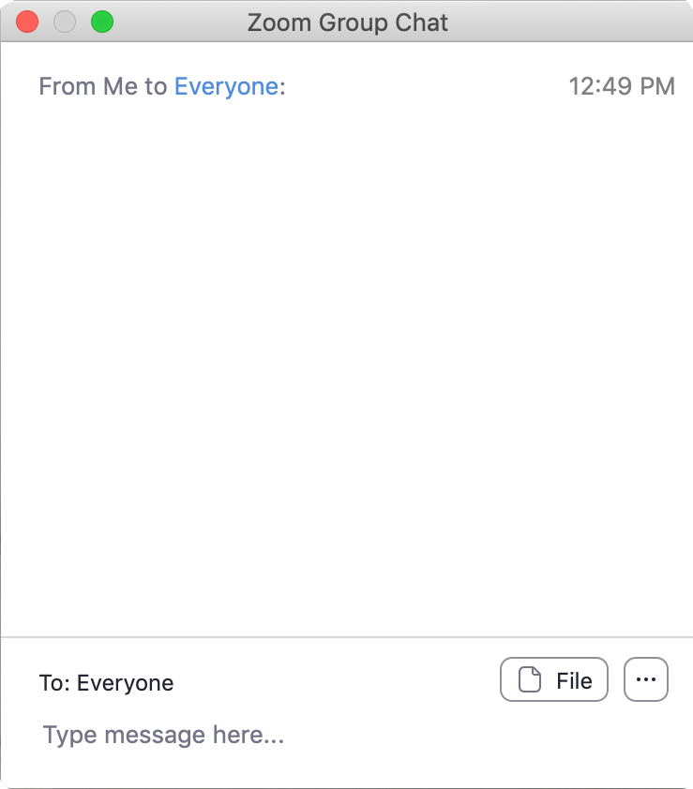
We Encourage Clinicians in Practice to Submit Questions
Feel free to submit questions now before the program begins and throughout the program.

Slide 10
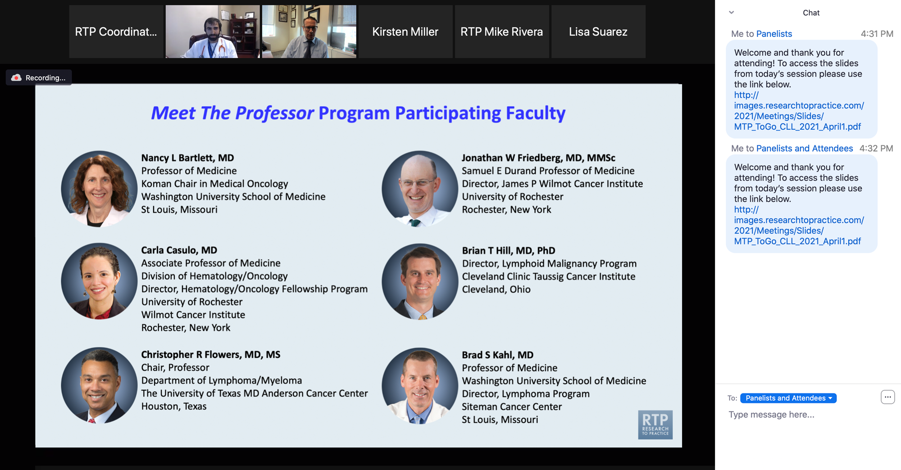
Familiarizing Yourself with the Zoom Interface
Expand chat submission box
Drag the white line above the submission box up to create
more space for your message.

Slide 11
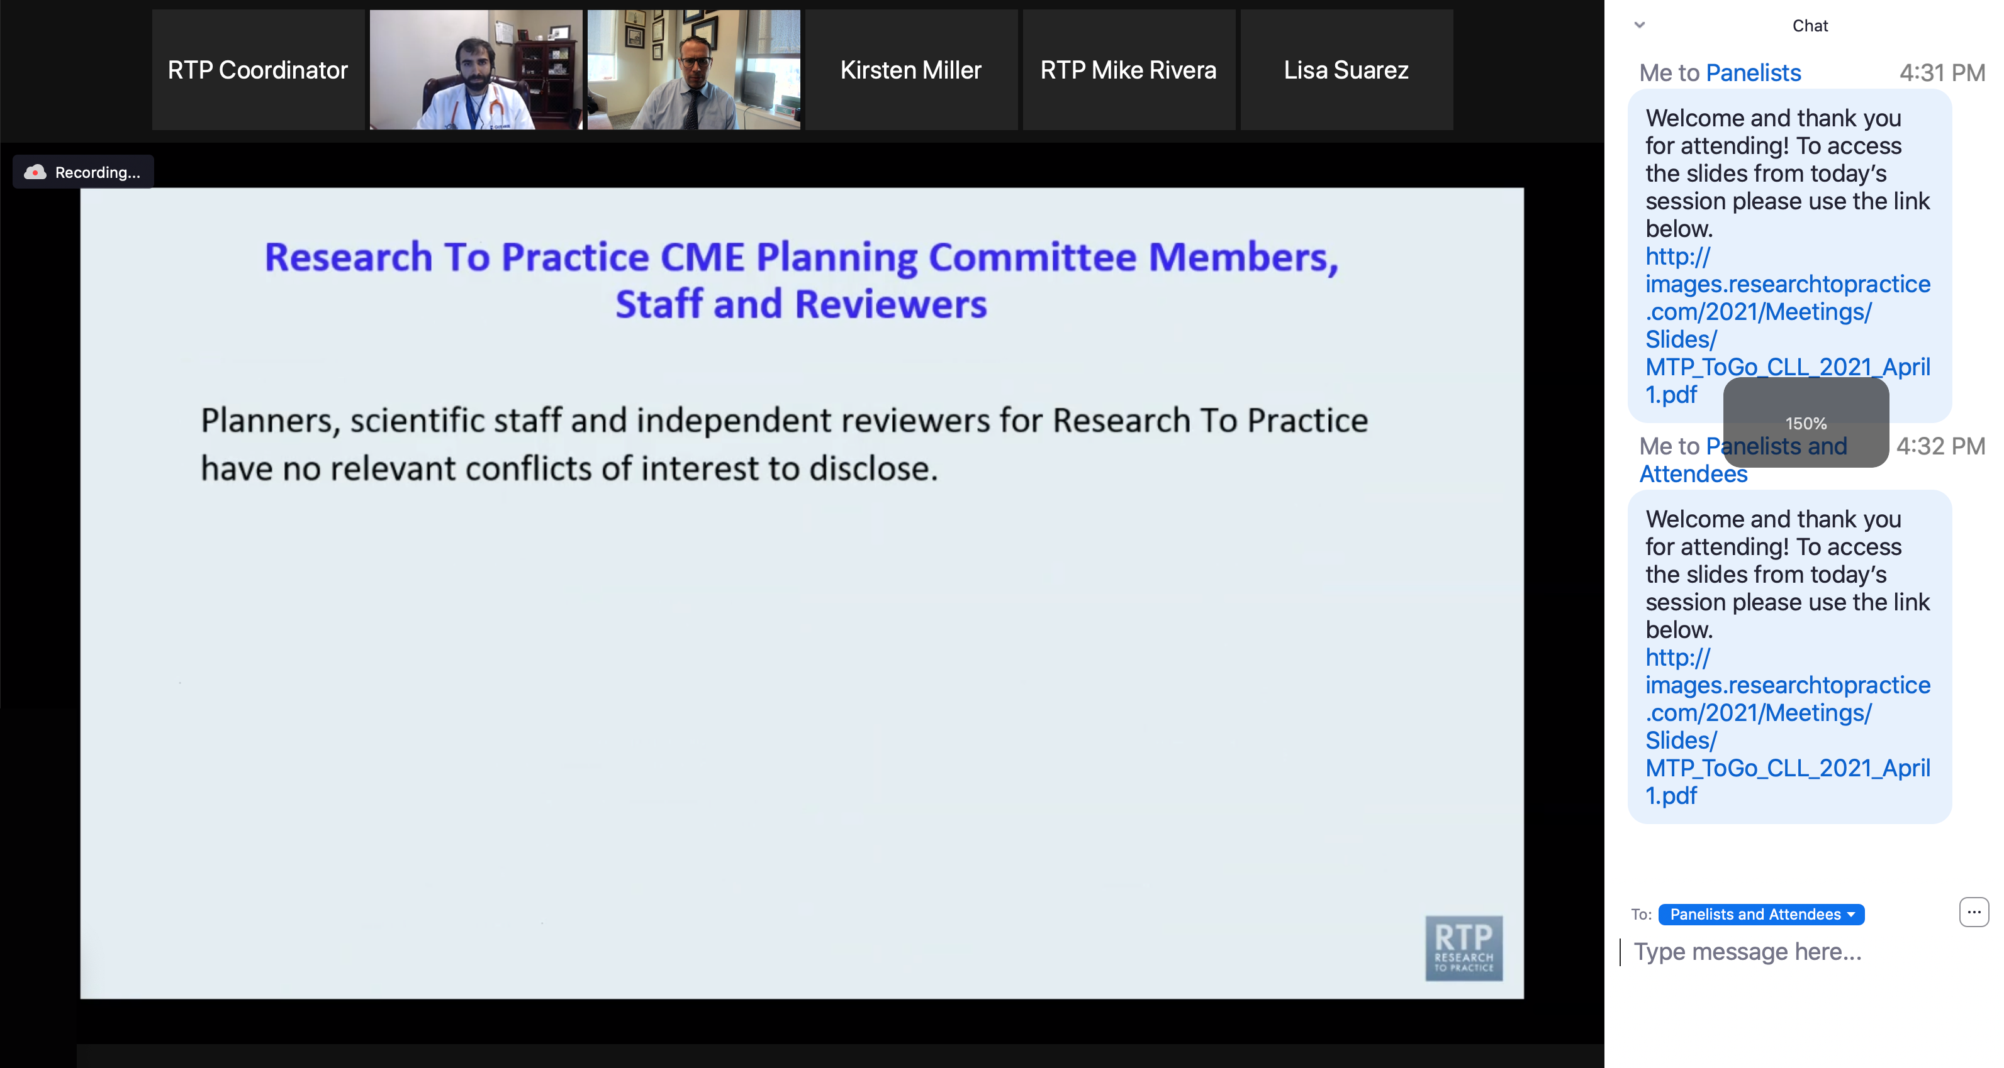
Familiarizing Yourself with the Zoom Interface
Increase chat font size
Press Command (for Mac) or Control (for PC) and the + symbol.
You may do this as many times as you need for readability.

Slide 12
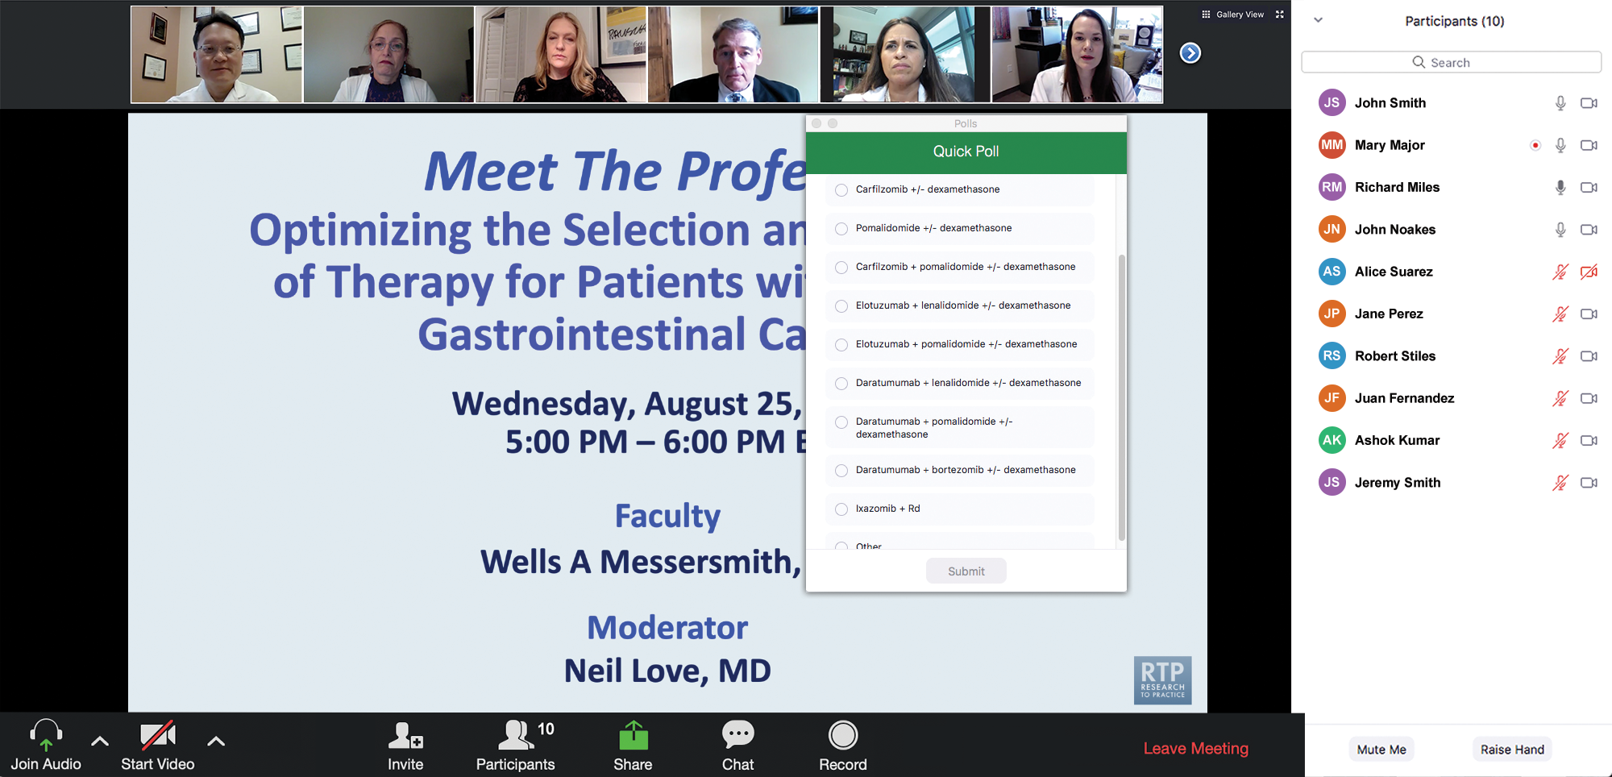
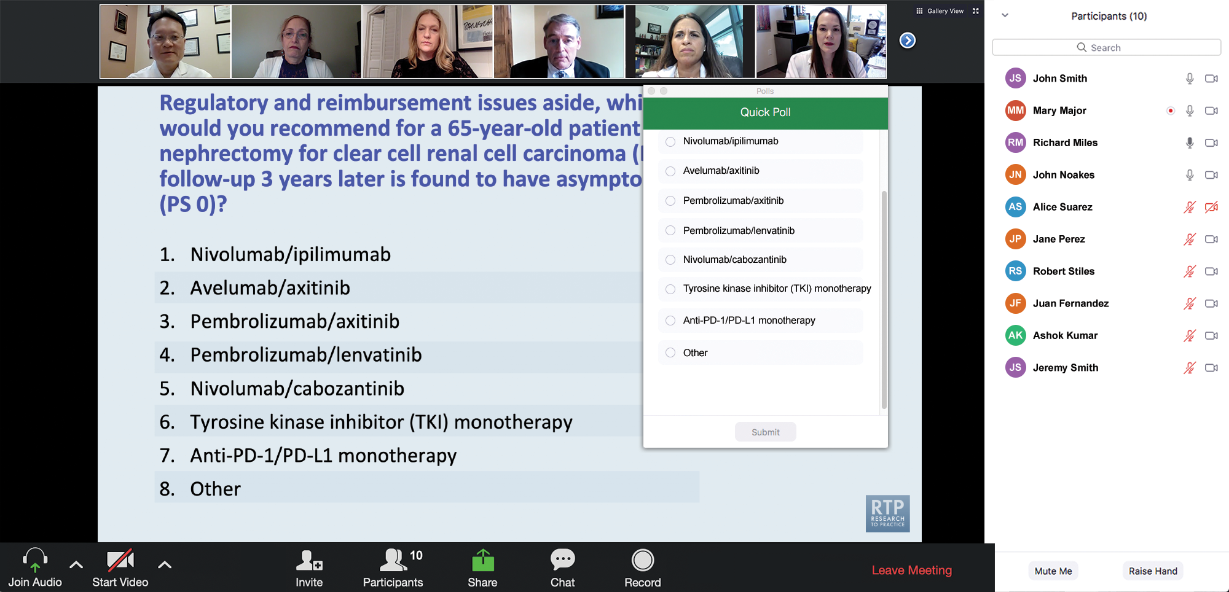
Clinicians in the Audience, Please Complete the Pre- and Postmeeting Surveys
Quick Survey
Quick Poll

Slide 13
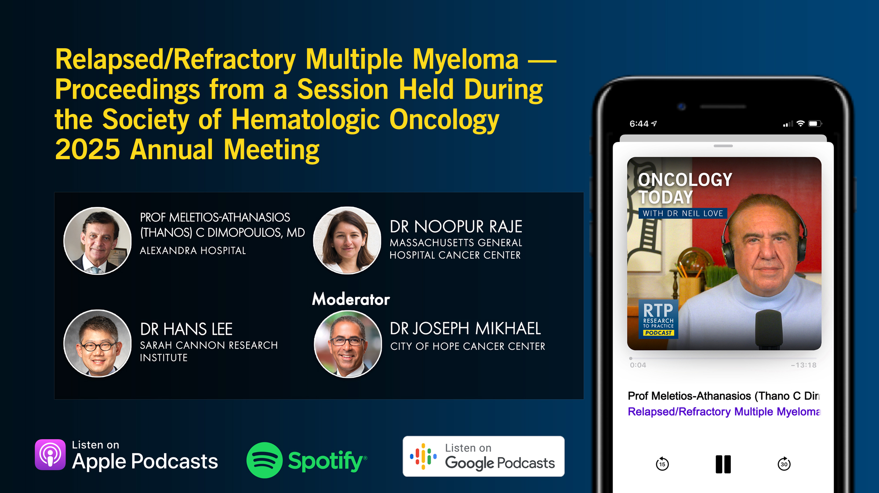

Slide 14
Practical Perspectives on the Current and Future Management of Immune Thrombocytopenia — What Happened at ASH 2025?
A CME/MOC-Accredited Live Webinar
Tuesday, December 16, 2025
5:00 PM – 6:30 PM ET
Faculty
Hanny Al-Samkari, MD
Cindy Neunert, MD, MSCS
Professor Francesco Zaja
Moderator
Neil Love, MD

Slide 15
Practical Perspectives on the Current Role of Bispecific Antibodies in the Management of Lymphoma — What Happened at ASH 2025?
A CME/MOC-Accredited Live Webinar
Wednesday, December 17, 2025
5:00 PM – 6:00 PM ET
Faculty
Michael Dickinson, MD
Laurie H Sehn, MD, MPH
Moderator
Neil Love, MD

Slide 16
Expert Second Opinion: Investigators Discuss the
Optimal Management of Gastrointestinal Cancers
A CME Symposium Series Held Adjunct to the
2026 ASCO® Gastrointestinal Cancers Symposium
HER2-Positive
Gastrointestinal Cancers
Thursday, January 8, 2026
7:15 PM – 8:45 PM PT
(10:15 PM – 11:45 PM ET)
Localized Colorectal Cancer
Thursday, January 8, 2026
7:15 PM – 8:45 PM PT
(10:15 PM – 11:45 PM ET)
Advanced Gastroesophageal Cancers
Friday, January 9, 2026
6:00 PM – 8:00 PM PT
(9:00 PM – 11:00 PM ET)

Slide 17
Grand Rounds
CME/MOC-Accredited Interactive Series
Through April 2026
Three Series
Optimizing Treatment
for Patients with Relapsed/Refractory Chronic Lymphocytic Leukemia
Optimizing the Use of
Novel Therapies for Patients with Diffuse
Large B-Cell Lymphoma
Optimizing Therapy for Patients with Hormone Receptor-Positive
Localized Breast Cancer
Host a 1-hour session at your institution:
Email Meetings@ResearchToPractice.com
or call (800) 233-6153

Slide 18

Save The Date
A Multitumor CME/MOC-, NCPD- and ACPE-Accredited Educational Conference Developed in Partnership with Florida Cancer Specialists & Research Institute
Friday to Sunday, April 24 to 26, 2026
The Ritz-Carlton Orlando, Grande Lakes | Orlando, Florida
Moderated by Neil Love, MD

Slide 19
Thank you for joining us! Please take a moment to complete the survey currently up on Zoom.
Your feedback is very important to us.
Information on how to obtain CME and ABIM MOC credit will be provided at the conclusion of the activity in the Zoom chat room. Attendees will also receive an email in 1 to 3 business days with these instructions.

Slide 20
Cases from the Community: Investigators Discuss Available Research Guiding the Management of Relapsed/Refractory Multiple Myeloma — What Happened at ASH 2025?
A CME/MOC-Accredited Live Webinar
Monday, December 15, 2025
5:00 PM – 6:00 PM ET
Faculty
Sagar Lonial, MD, FACP, FASCO
María-Victoria Mateos, MD, PhD
Moderator
Neil Love, MD

Slide 21
Faculty
Sagar Lonial, MD, FACP, FASCO
Chair and Professor
Department of Hematology and Medical Oncology
Chief Medical Officer
Winship Cancer Institute
Emory University School of Medicine
Atlanta, Georgia
MODERATOR
Neil Love, MD
Research To Practice
Miami, Florida
María-Victoria Mateos, MD, PhD
Consultant Physician in the Haematology Department
Associate Professor of Medicine
Director of the Myeloma Program
Clinical Trials Unit
University Hospital of Salamanca
Salamanca, Spain

Slide 22
We Encourage Clinicians in Practice to Submit Questions
Feel free to submit questions now before the program begins and throughout the program.

Slide 23
Clinicians in the Audience, Please Complete the Pre- and Postmeeting Surveys
Quick Survey
Quick Poll

Slide 25
Practical Perspectives on the Current and Future Management of Immune Thrombocytopenia — What Happened at ASH 2025?
A CME/MOC-Accredited Live Webinar
Tuesday, December 16, 2025
5:00 PM – 6:30 PM ET
Faculty
Hanny Al-Samkari, MD
Cindy Neunert, MD, MSCS
Professor Francesco Zaja
Moderator
Neil Love, MD

Slide 26
Practical Perspectives on the Current Role of Bispecific Antibodies in the Management of Lymphoma — What Happened at ASH 2025?
A CME/MOC-Accredited Live Webinar
Wednesday, December 17, 2025
5:00 PM – 6:00 PM ET
Faculty
Michael Dickinson, MD
Laurie H Sehn, MD, MPH
Moderator
Neil Love, MD

Slide 27
Expert Second Opinion: Investigators Discuss the
Optimal Management of Gastrointestinal Cancers
A CME Symposium Series Held Adjunct to the
2026 ASCO® Gastrointestinal Cancers Symposium
HER2-Positive
Gastrointestinal Cancers
Thursday, January 8, 2026
7:15 PM – 8:45 PM PT
(10:15 PM – 11:45 PM ET)
Localized Colorectal Cancer
Thursday, January 8, 2026
7:15 PM – 8:45 PM PT
(10:15 PM – 11:45 PM ET)
Advanced Gastroesophageal Cancers
Friday, January 9, 2026
6:00 PM – 8:00 PM PT
(9:00 PM – 11:00 PM ET)

Slide 28
Grand Rounds
CME/MOC-Accredited Interactive Series
Through April 2026
Three Series
Optimizing Treatment
for Patients with Relapsed/Refractory Chronic Lymphocytic Leukemia
Optimizing the Use of
Novel Therapies for Patients with Diffuse
Large B-Cell Lymphoma
Optimizing Therapy for Patients with Hormone Receptor-Positive
Localized Breast Cancer
Host a 1-hour session at your institution:
Email Meetings@ResearchToPractice.com
or call (800) 233-6153

Slide 29
Save The Date
A Multitumor CME/MOC-, NCPD- and ACPE-Accredited Educational Conference Developed in Partnership with Florida Cancer Specialists & Research Institute
Friday to Sunday, April 24 to 26, 2026
The Ritz-Carlton Orlando, Grande Lakes | Orlando, Florida
Moderated by Neil Love, MD

Slide 30
Cases from the Community: Investigators Discuss Available Research Guiding the Management of Relapsed/Refractory Multiple Myeloma — What Happened at ASH 2025?
A CME/MOC-Accredited Live Webinar
Monday, December 15, 2025
5:00 PM – 6:00 PM ET
Faculty
Sagar Lonial, MD, FACP, FASCO
María-Victoria Mateos, MD, PhD
Moderator
Neil Love, MD

Slide 31
Dr Lonial — Disclosures
Advisory Committees and Consulting Agreements | AbbVie Inc, Amgen Inc, Bristol Myers Squibb, Genentech, a member of the Roche Group, GSK, Janssen Biotech Inc, Novartis, Pfizer Inc, Regeneron Pharmaceuticals Inc, Takeda Pharmaceuticals USA Inc; Boards of Directors: TG Therapeutics Inc
Contracted Research | Bristol Myers Squibb, Janssen Biotech Inc, Novartis, Takeda Pharmaceuticals USA Inc
Stock Options/Stock — Public Companies | TG Therapeutics Inc

Slide 32
Dr Mateos — Disclosures
Advisory Committees and Speakers Bureaus | Amgen Inc, AstraZeneca Pharmaceuticals LP, Bristol Myers Squibb, GSK, Johnson & Johnson, Kite, A Gilead Company, Menarini Group, Oncopeptides, Pfizer Inc, Regeneron Pharmaceuticals Inc, Sanofi, Stemline Therapeutics Inc

Slide 33
Dr Love — Disclosures
Dr Love is president and CEO of Research To Practice. Research To Practice receives funds in the form of educational grants to develop CME activities from the following companies: Aadi Bioscience, AbbVie Inc, ADC Therapeutics, Agendia Inc, Alexion Pharmaceuticals, Amgen Inc, Array BioPharma Inc, a subsidiary of Pfizer Inc, Arvinas, Astellas, AstraZeneca Pharmaceuticals LP, Aveo Pharmaceuticals, Bayer HealthCare Pharmaceuticals, BeOne, Biotheranostics Inc, A Hologic Company, Black Diamond Therapeutics Inc, Blueprint Medicines, Boehringer Ingelheim Pharmaceuticals Inc, Bristol Myers Squibb, Celcuity, Clovis Oncology, Coherus BioSciences, Corcept Therapeutics Inc, CTI BioPharma, a Sobi Company, Daiichi Sankyo Inc, Eisai Inc, Elevation Oncology Inc, Exact Sciences Corporation, Exelixis Inc, Genentech, a member of the Roche Group, Genmab US Inc, Geron Corporation, Gilead Sciences Inc, GSK, Helsinn Therapeutics (US) Inc, ImmunoGen Inc, Incyte Corporation, Ipsen Biopharmaceuticals Inc, Jazz Pharmaceuticals Inc, Johnson & Johnson, Karyopharm Therapeutics, Kite, A Gilead Company, Kura Oncology, Legend Biotech, Lilly, MEI Pharma Inc, Merck, Mersana Therapeutics Inc, Mirati Therapeutics Inc, Mural Oncology Inc, Natera Inc, Novartis, Novartis Pharmaceuticals Corporation on behalf of Advanced Accelerator Applications, Novocure Inc, Nuvalent, Pfizer Inc, Pharmacyclics LLC, an AbbVie Company, Puma Biotechnology Inc, Regeneron Pharmaceuticals Inc, Rigel Pharmaceuticals Inc, R-Pharm US, Sanofi, Seagen Inc, Servier Pharmaceuticals LLC, SpringWorks Therapeutics Inc, Stemline Therapeutics Inc, Sumitomo Pharma America, Syndax Pharmaceuticals, Taiho Oncology Inc, Takeda Pharmaceuticals USA Inc, TerSera Therapeutics LLC, and Tesaro, A GSK Company.

Slide 34
Commercial Support
This activity is supported by an educational grant from GSK.
Research To Practice CME Planning Committee Members,
Staff and Reviewers
Planners, scientific staff and independent reviewers for Research To Practice have no relevant conflicts of interest to disclose.

Slide 35
This educational activity contains discussion of
non-FDA-approved uses of agents and regimens. Please refer to official prescribing information for each product for approved indications.

Slide 36
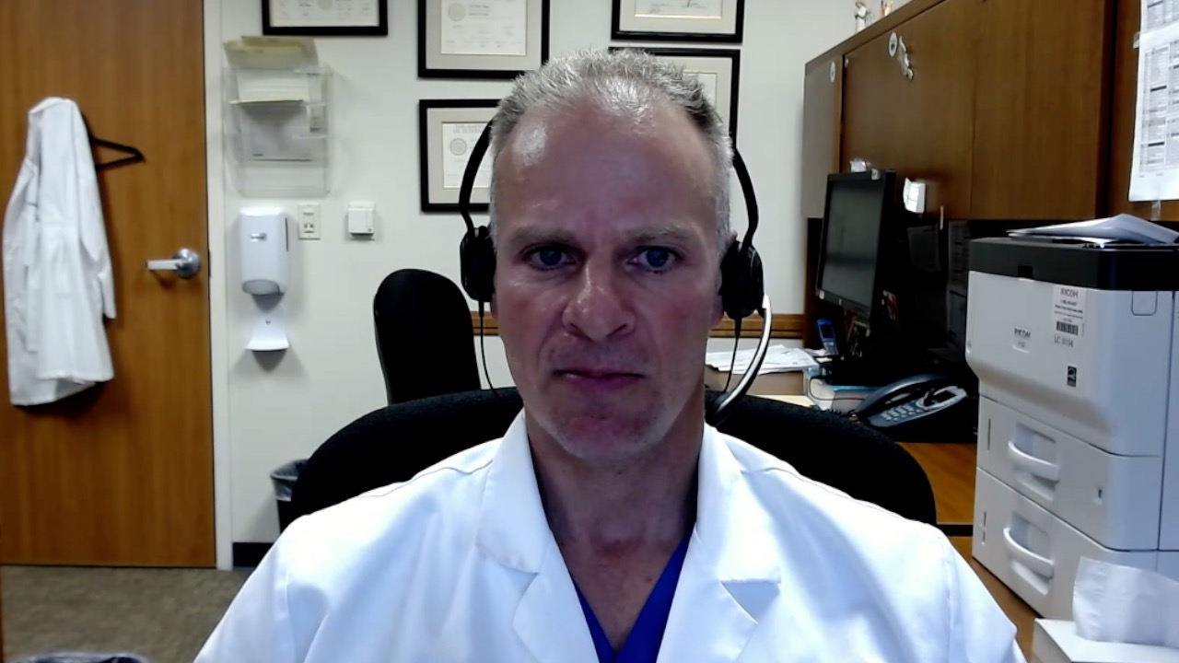
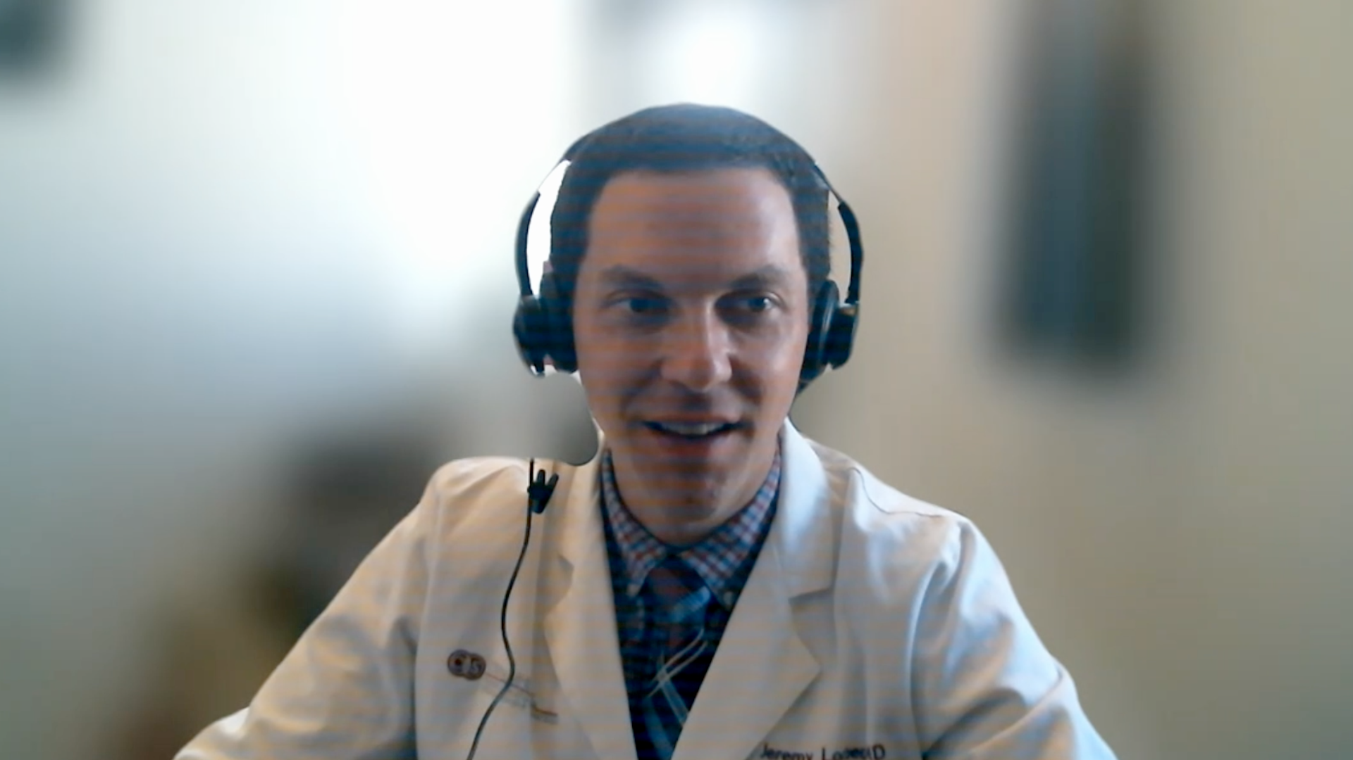
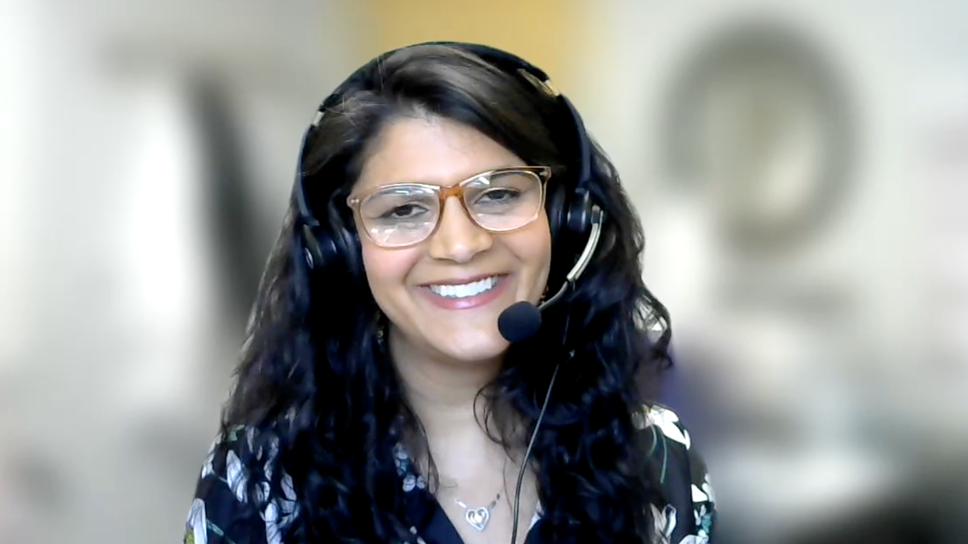
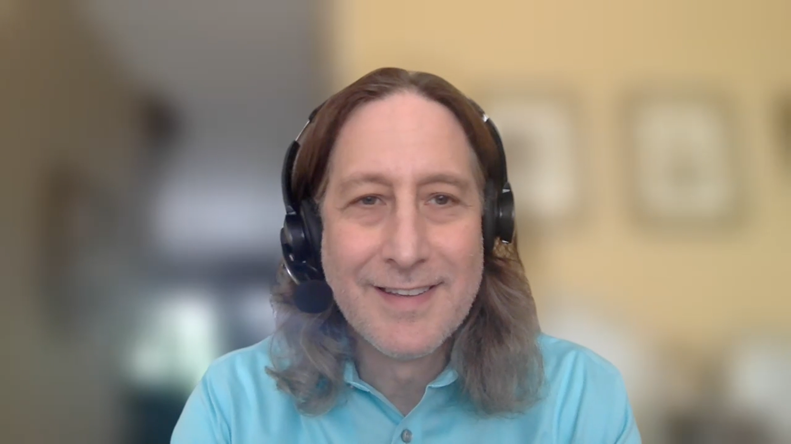
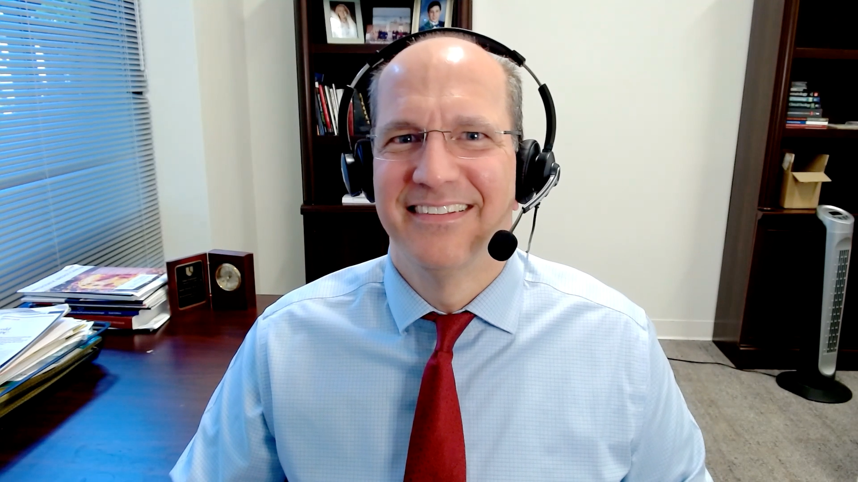
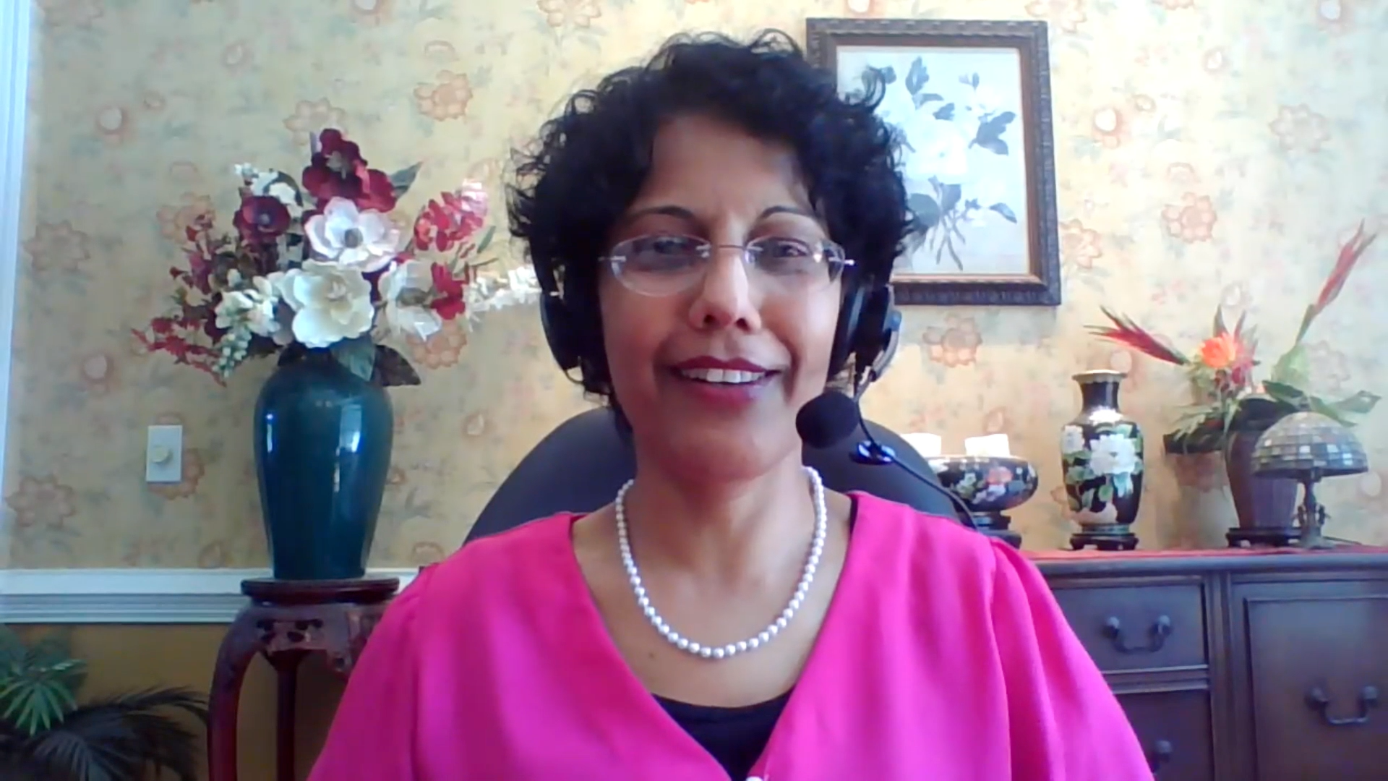
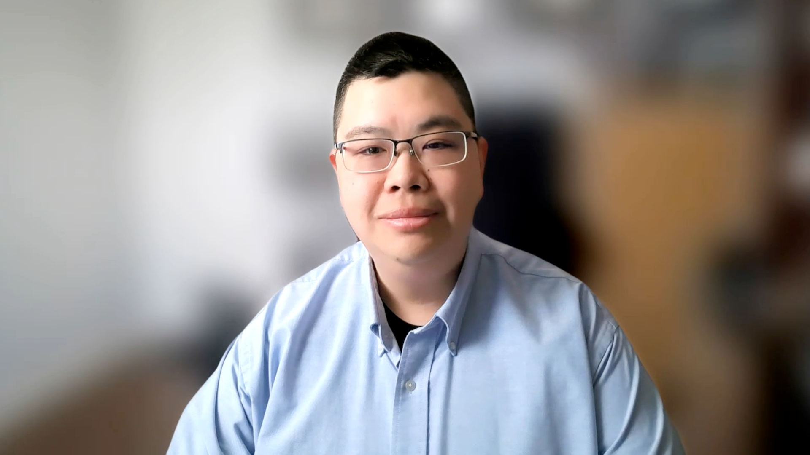
Contributing General Medical Oncologists
Warren S Brenner, MD
Lynn Cancer Institute
Boca Raton, Florida
Jeremy Lorber, MD
Cedars-Sinai Medical Center
Beverly Hills, California
Bhavana (Tina) Bhatnagar, DO WVU Cancer Institute
Wheeling, West Virginia
Neil Morganstein, MD
Atlantic Health System
Summit, New Jersey
Justin Favaro, MD, PhD
Oncology Specialists of Charlotte
Charlotte, North Carolina
Priya Rudolph, MD, PhD
Georgia Cancer Specialists
Athens, Georgia
Eric H Lee, MD, PhD
Los Angeles Cancer Network
Fountain Valley, California

Slide 37
Key Datasets
Sagar Lonial, MD
Hungria V et al. Long-term responders from the phase 3 DREAMM-7 study of belantamab mafodotin plus bortezomib and dexamethasone vs daratumumab plus bortezomib and dexamethasone in relapsed/refractory multiple myeloma. ASH 2025;Abstract 7236.
Trudel S et al. Deep responses and durable outcomes in patients treated with belantamab mafodotin plus pomalidomide and dexamethasone from long-term follow-up of the phase 3 DREAMM-8 study. ASH 2025;Abstract 7677.
Lonial S et al. Health-related quality of life with belantamab mafodotin in patients with relapsed or refractory multiple myeloma (RRMM): An exploratory analysis of overall quality of life in DREAMM-7. ASH 2025;Abstract 143.
Lonial S et al. Belantamab mafodotin (belamaf) ocular events are manageable and reversible with dose modifications guided by standard assessments. ASH 2025;Abstract 12045.
Usmani S et al. Belantamab mafodotin (belamaf) in combination with bortezomib, lenalidomide, and dexamethasone (VRd) for patients (pts) with transplant-ineligible (TI) newly diagnosed multiple myeloma (NDMM): A focus on treatment efficacy and management/resolution of ocular events in the phase 1 DREAMM-9 study. ASH 2025;Abstract 13646.

Slide 38
Key Datasets
Sagar Lonial, MD (continued)
Landgren O et al. A phase 2 trial of iberdomide, carfilzomib, daratumumab and dexamethasone quadruplet therapy for relapsed/refractory multiple myeloma: The ReKInDLE study. ASH 2025;Abstract 4108.
Sim S et al. Interim analysis of efficacy and safety for ALLG MM25 (Viber-M): A phase I b/II study of venetoclax, iberdomide and dexamethasone for patients in first or second relapse of multiple myeloma with t(11;14). ASH 2025;Abstract 7320.

Slide 39
Key Datasets
María-Victoria Mateos, MD, PhD
Costa L et al. Long-term progression-free survival benefit with ciltacabtagene autoleucel in standard-risk relapsed/refractory multiple myeloma. ASH 2025;Abstract 9129.
Parekh S et al. Earlier use of ciltacabtagene autoleucel (cilta-cel) is associated with better immune fitness and stronger immune effects as shown by correlative analysis of peripheral blood and the bone marrow tumor microenvironment (TME) from the CARTITUDE-4 study. ASH 2025;Abstract 8211.
Ailawadhi S et al. KarMMa-3 subgroup analysis in older patients with relapsed/refractory multiple myeloma treated with idecabtagene vicleucel. ASH 2025;Abstract 9044.
Patel K et al. Phase 2 registrational study of anitocabtagene autoleucel for the treatment of patients with relapsed and/or refractory multiple myeloma: Updated results from iMMagine-1. ASH 2025;Abstract 4541.
Ho PJ et al. Minimal residual disease (MRD)-negative outcomes following a novel, in vivo gene therapy generating anti–B-cell maturation antigen (BCMA) chimeric antigen receptor (CAR)-T cells in patients with relapsed and refractory multiple myeloma (RRMM): Preliminary results from inMMyCAR, the first-in-human phase 1 study of KLN-1010. ASH 2025;Abstract LBA-1.

Slide 40
Key Datasets
María-Victoria Mateos, MD, PhD (continued)
Ho PJ et al. Subcutaneous cevostamab demonstrates manageable safety and clinically meaningful activity in relapsed/refractory multiple myeloma (RRMM): First results from the phase Ib CAMMA 3 study. ASH 2025;Abstract 8172.
Mateos M-V et al. Safety and efficacy of talquetamab + teclistamab in patients with relapsed/refractory multiple myeloma from Phase 1b of RedirecTT-1: Results with an extended median follow-up of 3 years. ASH 2025;Abstract 7712.
Mateos M-V et al. Phase 3 randomized study of teclistamab plus daratumumab versus investigator’s choice of daratumumab and dexamethasone with either pomalidomide or bortezomib (DPd/DVd) in patients (Pts) with relapsed refractory multiple myeloma (RRMM): Results of MajesTEC-3. ASH 2025;Abstract LBA-6.
Voorhees P et al. Etentamig plus pomalidomide-dexamethasone combination therapy in relapsed or refractory multiple myeloma: A phase 1b dose-escalation and safety expansion study. ASH 2025;Abstract 1875.
Hamadeh I et al. Low dose tocilizumab for mitigation of cytokine release syndrome with bispecific antibodies in relapsed/refractory multiple myeloma. ASH 2025;Abstract 7258.
Krishnan A et al. Updated efficacy and safety results of JNJ-5322, a novel, next-generation BCMA×GPRC5D×CD3 trispecific antibody, in patients with relapsed/refractory multiple myeloma. ASH 2025;Abstract 7875.

Slide 41
Agenda
Introduction | Dr Yannucci – 60-year-old man | Best of ASH Multiple Myeloma
Case 1 | Dr Morganstein – 62-year-old man | Dr Lorber – 59-year-old man
Faculty Presentation: Antibody-Drug Conjugates and Other Emerging Novel Therapies for Relapsed/Refractory (R/R) Multiple Myeloma (MM) — Dr Lonial
Case 2 | Dr Morganstein – 84-year-old man
Case 3 | Dr Favaro – 64-year-old man
Case 4 | Dr Bhatnager – 71-year-old man
Case 5 | Dr Lee – 71-year-old man
Faculty Presentation: Integrating CAR T-Cell Therapy and Bispecific Antibodies into the Management of R/R MM — Dr Mateos
Case 6 | Dr Rudolph – 56-year-old man

Slide 42
Agenda
Introduction | Dr Yannucci – 60-year-old man | Best of ASH Multiple Myeloma
Case 1 | Dr Morganstein – 62-year-old man | Dr Lorber – 59-year-old man
Faculty Presentation: Antibody-Drug Conjugates and Other Emerging Novel Therapies for Relapsed/Refractory (R/R) Multiple Myeloma (MM) — Dr Lonial
Case 2 | Dr Morganstein – 84-year-old man
Case 3 | Dr Favaro – 64-year-old man
Case 4 | Dr Bhatnager – 71-year-old man
Case 5 | Dr Lee – 71-year-old man
Faculty Presentation: Integrating CAR T-Cell Therapy and Bispecific Antibodies into the Management of R/R MM — Dr Mateos
Case 6 | Dr Rudolph – 56-year-old man

Slide 43

LBA-1
MRD-negative outcomes following a novel, in vivo gene therapy generating anti-BCMA CAR-T cells in patients with RRMM: Preliminary results from inMMyCAR, the first-in-human Phase 1 study of KLN-1010
Simon Harrison¹, P. Joy Ho², Sueh-li Lim³, Stephanie Talam², Hannah Pahl¹, Dharmesh Dingar⁴, Scott Currence⁴, Travis Quigley⁴, Andrew Spencer³
¹Peter MacCallum Cancer Centre, Melbourne, Victoria, Australia; ²Royal Prince Alfred Hospital, Sydney, New South Wales, Australia; ³The Alfred Hospital, Melbourne, Victoria, Australia; ⁴Kelonia Therapeutics, Inc., Boston, Massachusetts, United States.
Presented at the 67th ASH Annual Meeting and Exposition; December 6-9, 2025; Orlando, FL, USA.

Slide 44
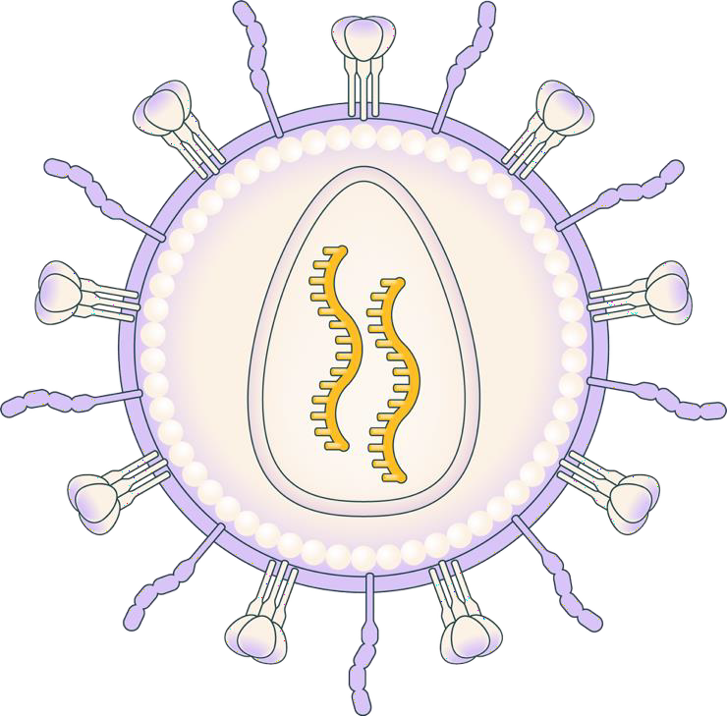


KLN-1010: a modified LVV generating anti-BCMA CAR-T cells
in vivo
Envelope-modified, replication-incompetent, self-inactivating lentiviral vector
De-targeted VSV-G fusogen avoids delivery to LDL-expressing cells while maintaining high transduction efficiency
Precise re-targeting to T cells with a CD3 scFv; avoids liver uptake and drug sinks
Anti-BCMA CAR was selected based on high levels of activity to BCMA-positive tumors
De-targeted fusogen,
VSV-G mutation
T cell re-targeting with CD3
tropism molecule
CAR molecule
Proprietary, fully-human BCMA scFv
4-1BB
CD3ζ
BCMA, anti–B-cell maturation antigen; CAR, chimeric antigen receptor; CD3, cluster of differentiation 3; CD3ζ, cluster of differentiation 3 zeta chain; LDL, low-density lipoprotein; LVV, lentiviral vector;scFv, single-chain variable fragment;
VSV-G, vesicular stomatitis virus glycoprotein.
Wood JT et al. Toward treatment with gene-modified B cells engineered in vivo using iGPS particles (abstract #1281). Poster presented at: ASGCT 28th Annual Meeting; May 13-17, 2025.

Slide 45



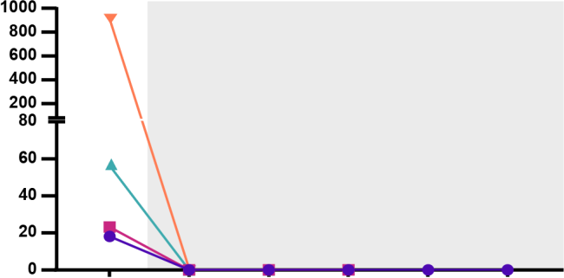
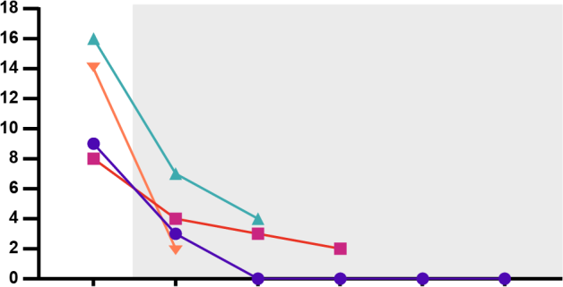
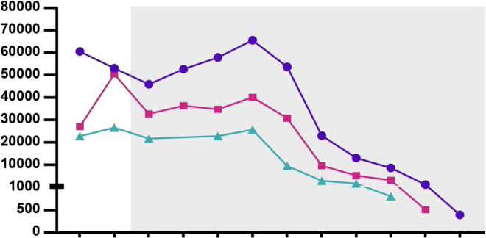


Deep, ongoing MRD-negative responses were observed across first 4 patients
Months post treatment
3 4
CR
1
2
5
6
VGPR
Patient 1
Patient 2
Patient 3
Patient 4
u
PR
MRD negative 10⁻⁶
MRD negative 10⁻⁵
*Most sensitive result from next
generation flow cytometry or sequencing
u
Involved sFLC
Post-infusion
M-spike levels
Post-infusion
Soluble BCMA
Post-infusion
M-spike (g/L)
sBCMA (pg/mL)
sFLC (mg/L)
Patient 1, DL1
Patient 2, DL1
Patient 3, DL1
Patient 4, DL-1
BCMA, B-cell maturation antigen; BL, baseline; CR, complete response; D, study day; M, study month; M-spike, monoclonal protein spike; MRD, minimal residual disease; PR, partial response; SCR, screening; sFLC, serum free light chain;
u, unconfirmed response; VGPR, very good partial response.

Slide 46
Favorable toxicity profile compared to ex vivo CAR T
Minimal events of cytopenia; only 1 case of Grade 4 (transient neutropenia related to margination)
Markedly lower number of events compared to ex vivo CAR-T therapies
TEAEs in >1 patient | Grade 1-2, n | Grade ≥3, n
IRR | 2 | 1 (DLT)
Lymphocytosis | 1 | 1
Hypomagnesemia | 2 | 0
Hypokalemia | 2 | 0
Cytopenia
 | Grade ≥3, n | Study day | Duration, days
Anemia | 1 | 15 | 2
Thrombocytopenia | 1 | 16 | 2
Neutropenia | 2 | 1, 15 | 2, 2
 |  | 14 | 3
TEAEs Grade ≥3 | Patients, n | Study day | Duration, days
Febrile neutropenia | 1 | 1 | 2
IRR | 1 | 1 | 3
Lymphopenia | 1 | 2, 8 | 2, 5
Lymphocytosis | 1 | 13 | 3
Anemia | 1 | 15 | 2
Vasovagal syncope | 1 | 27 | 1
Pneumonia | 1 | 86 | 8
Infusion-related reactions
 | Grade 1-2, n | Grade ≥3, n | Supportive care
Dose level 1 | 1 | 1 | Tocilizumab, steroid
Dose level -1 | 1 | 0 | Paracetamol
CAR, chimeric antigen receptor; DLT, dose-limiting toxicity; IRR, infusion-related reaction; TEAE, treatment-emergent adverse event.

Slide 47
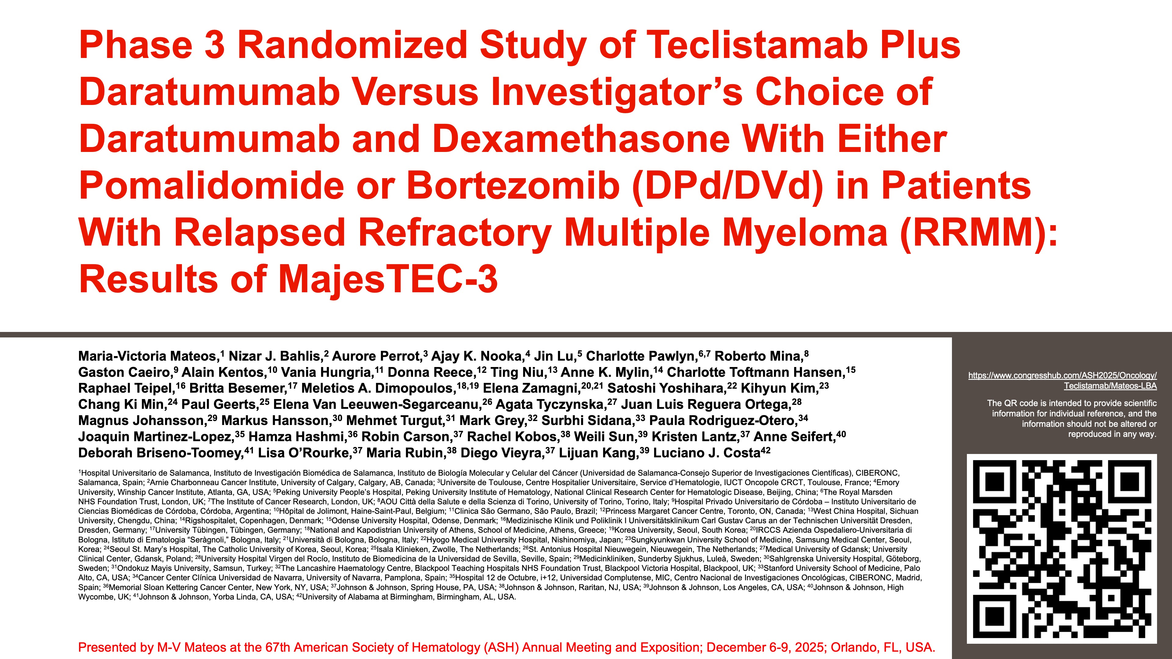

Slide 48
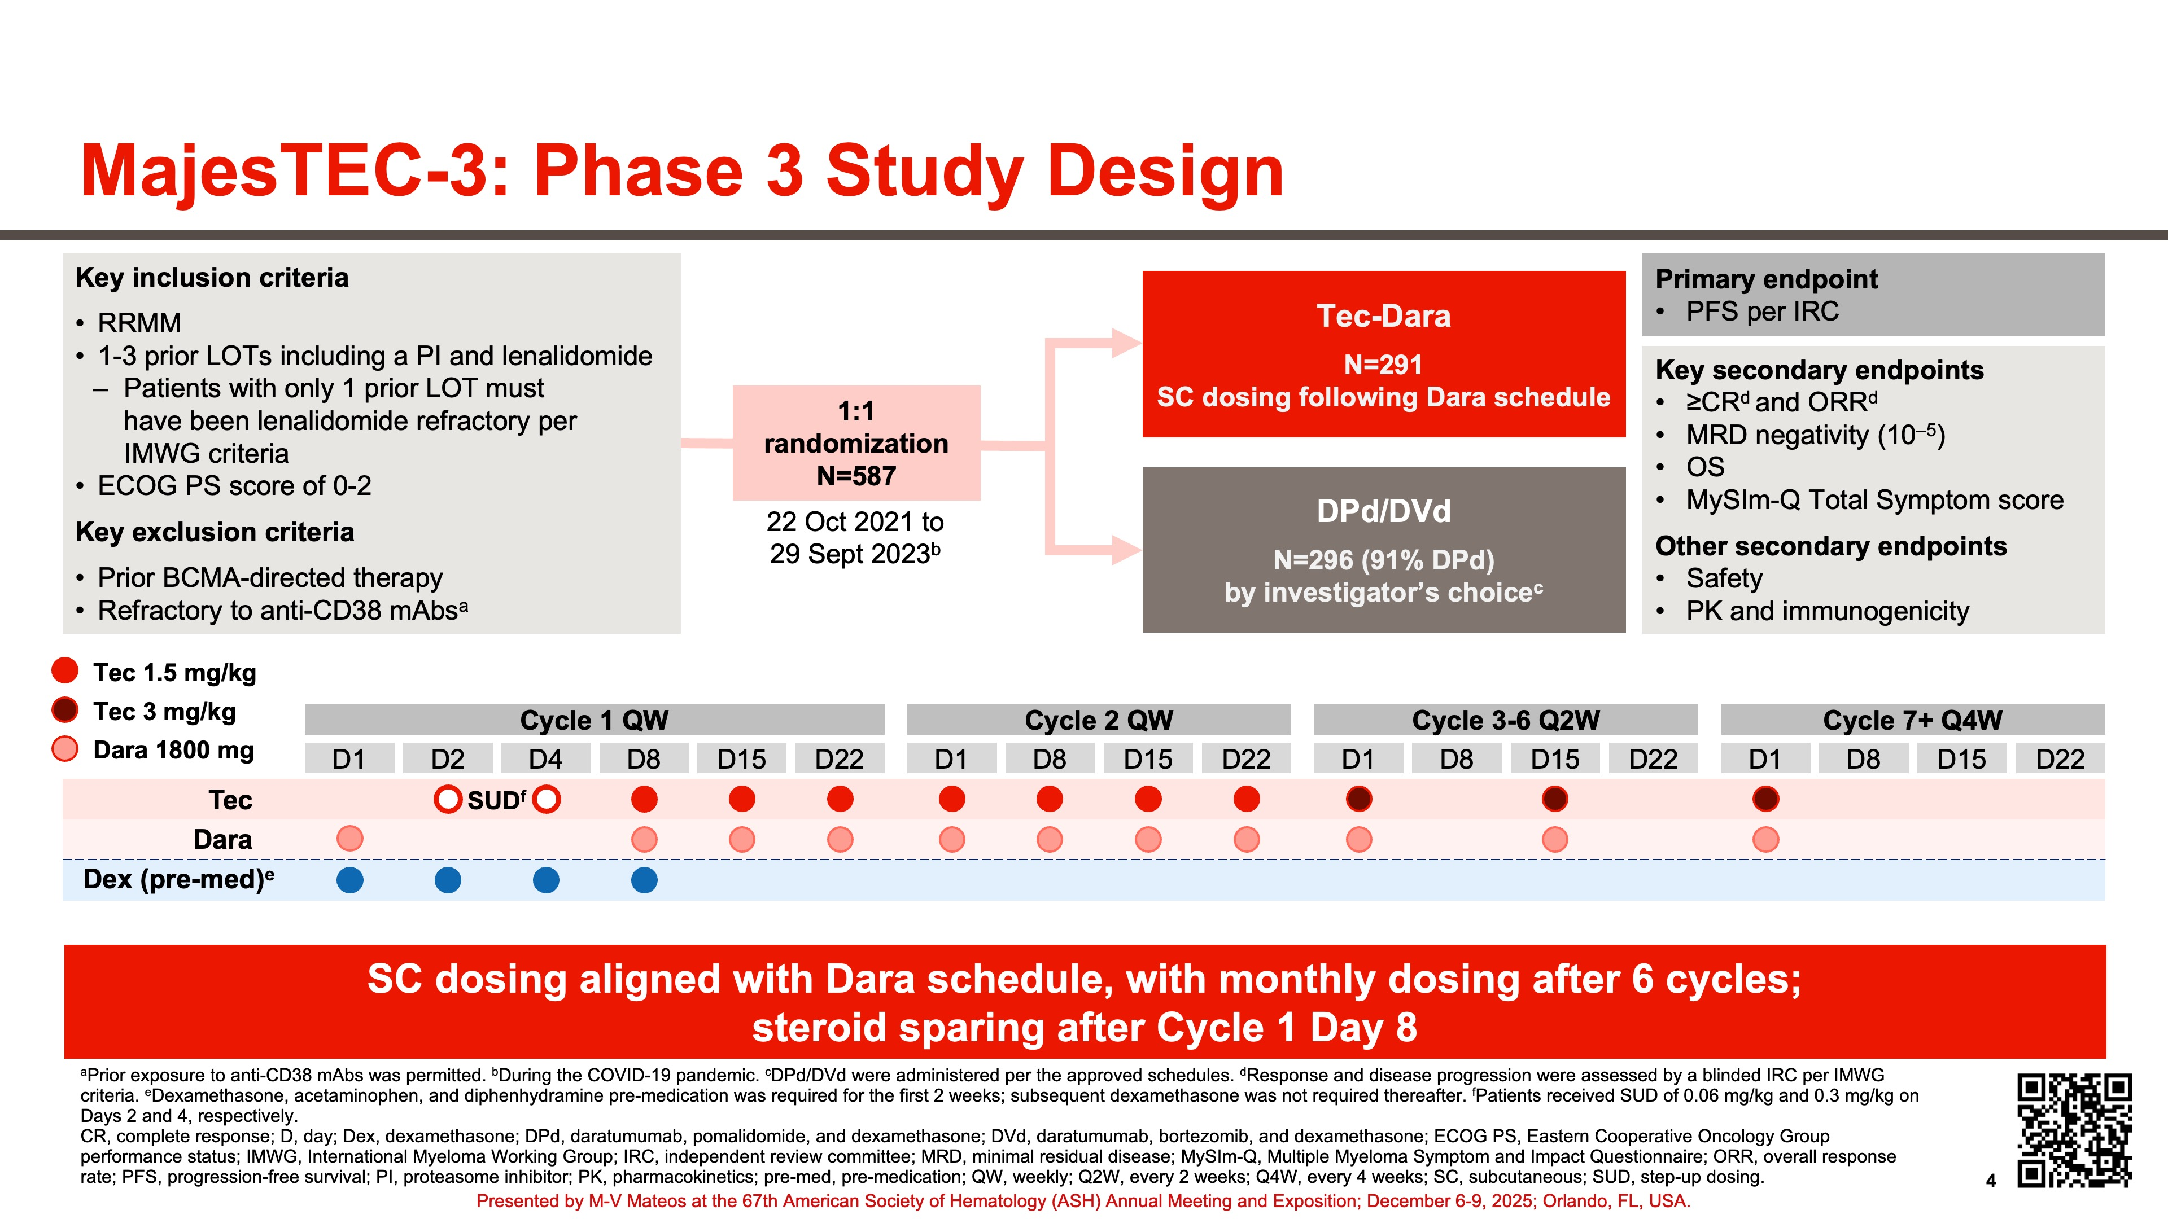

Slide 49
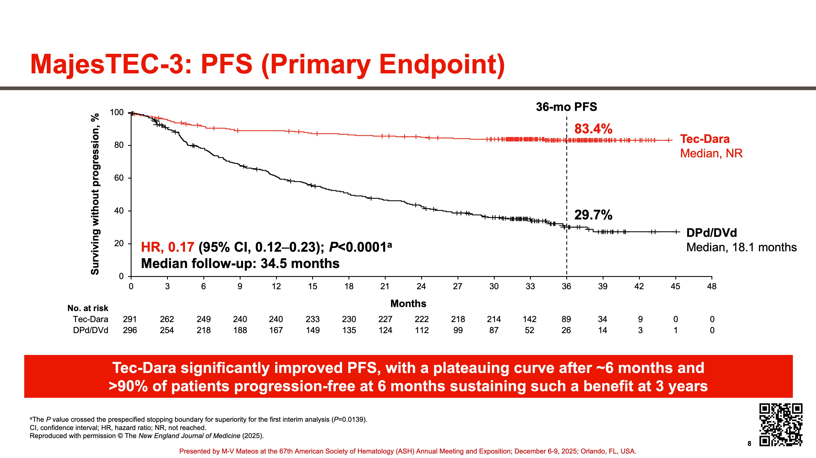

Slide 50
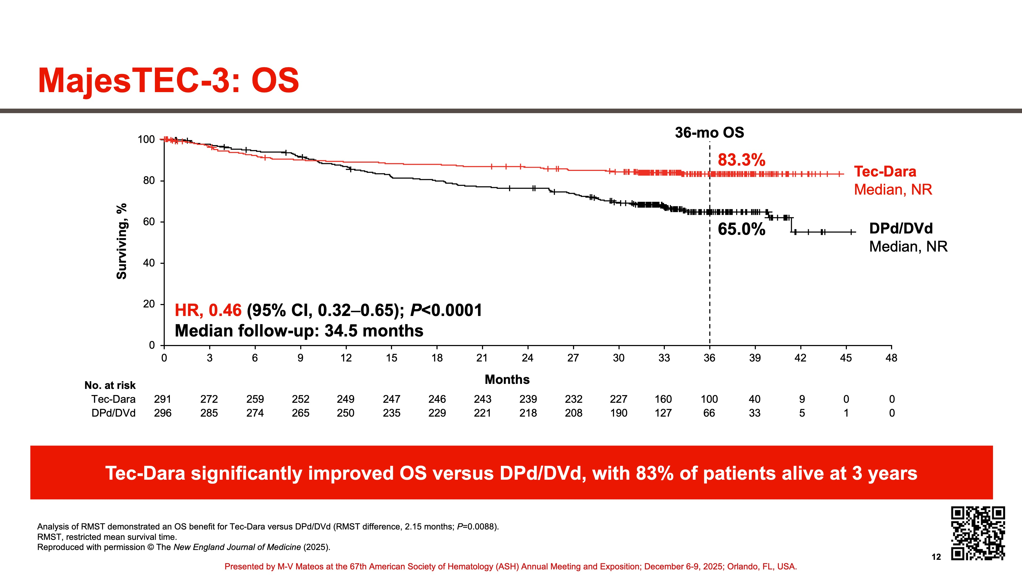

Slide 51
Agenda
Introduction | Dr Yannucci – 60-year-old man | Best of ASH Multiple Myeloma
Case 1 | Dr Morganstein – 62-year-old man | Dr Lorber – 59-year-old man
Faculty Presentation: Antibody-Drug Conjugates and Other Emerging Novel Therapies for Relapsed/Refractory (R/R) Multiple Myeloma (MM) — Dr Lonial
Case 2 | Dr Morganstein – 84-year-old man
Case 3 | Dr Favaro – 64-year-old man
Case 4 | Dr Bhatnager – 71-year-old man
Case 5 | Dr Lee – 71-year-old man
Faculty Presentation: Integrating CAR T-Cell Therapy and Bispecific Antibodies into the Management of R/R MM — Dr Mateos
Case 6 | Dr Rudolph – 56-year-old man

Slide 52
Case Presentation: 59-year-old man with t (11;14) IgA kappa myeloma discovered during workup for new Stage IV kidney disease. Chest wall plasmacytoma.
Receives daratumumab with CyBorD and radiation therapy to the plasmacytoma with minimal response
Dr Jeremy Lorber
(Beverly Hills, California)
Questions for the faculty
Dr Warren Brenner
(Boca Raton, Florida)

Slide 53
Agenda
Introduction | Dr Yannucci – 60-year-old man | Best of ASH Multiple Myeloma
Case 1 | Dr Morganstein – 62-year-old man | Dr Lorber – 59-year-old man
Faculty Presentation: Antibody-Drug Conjugates and Other Emerging Novel Therapies for Relapsed/Refractory (R/R) Multiple Myeloma (MM) — Dr Lonial
Case 2 | Dr Morganstein – 84-year-old man
Case 3 | Dr Favaro – 64-year-old man
Case 4 | Dr Bhatnager – 71-year-old man
Case 5 | Dr Lee – 71-year-old man
Faculty Presentation: Integrating CAR T-Cell Therapy and Bispecific Antibodies into the Management of R/R MM — Dr Mateos
Case 6 | Dr Rudolph – 56-year-old man

Slide 54
FDA Approves Belantamab Mafodotin-blmf for Relapsed or Refractory Multiple Myeloma
Press Release: October 23, 2025
“The Food and Drug Administration approved belantamab mafodotin-blmf, a B-cell maturation antigen (BCMA)-directed antibody and microtubule inhibitor conjugate, with bortezomib and dexamethasone for adults with relapsed or refractory multiple myeloma who have received at least two prior lines of therapy, including a proteasome inhibitor and an immunomodulatory agent.
Efficacy was evaluated in DREAMM-7 (NCT04246047), an open-label, randomized, multicenter trial in adults with relapsed or refractory multiple myeloma who had received at least one line of prior therapy. ... Patients were randomized (1:1) to receive either belantamab mafodotin-blmf, bortezomib, and dexamethasone (BVd) or daratumumab, bortezomib, and dexamethasone (DVd).
Efficacy was established based on progression-free survival (PFS) and overall survival (OS). The median PFS was 31.3 months (95% confidence interval [CI]: 23.5, not reached [NR]) in the BVd arm and 10.4 months (95% CI: 7, 13.4) in the DVd arm (hazard ratio [HR] 0.31, 95% CI: 0.21, 0.47). The median OS was NR and 35.7 months (95% CI: 21.1, NR) in respective arms (HR 0.49, 95% CI: 0.32, 0.76).”
https://www.fda.gov/drugs/resources-information-approved-drugs/fda-approves-belantamab-mafodotin-blmf-relapsed-or-refractory-multiple-myeloma

Slide 55

Antibody Drug Conjugates and Other Emerging Novel Therapies for R/R MM
Sagar Lonial, MD
Professor and Chair
Department of Hematology and Medical Oncology
Anne and Bernard Gray Professor in Cancer
Chief Medical Officer, Winship Cancer Institute
Emory University School of Medicine

Slide 56
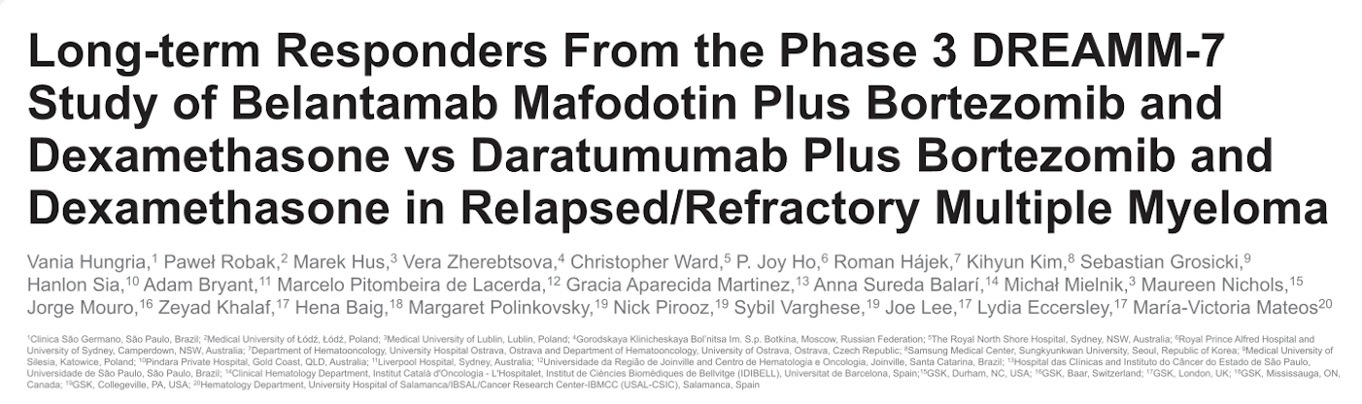
ASH 2025;Abstract 7236.

Slide 57
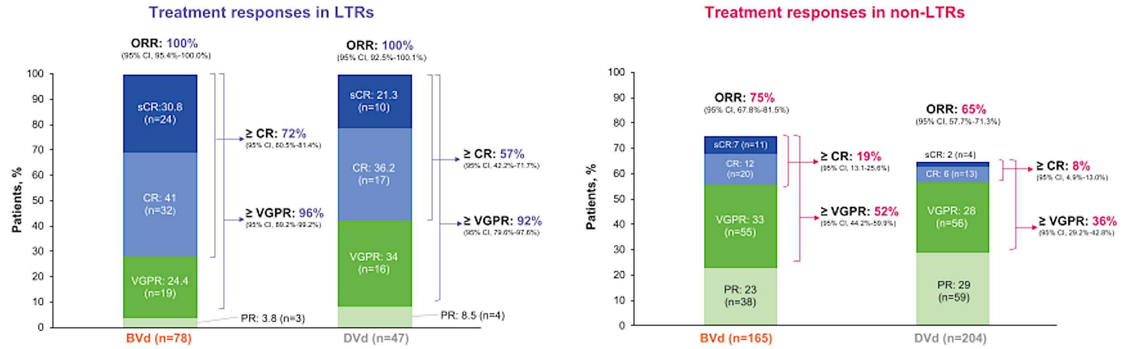
DREAMM-7: Responses in Long-Term Responders (LTRs) and Non-LTRs
ORR = overall response rate; CR = complete response; VGPR = very good partial response; PR = partial response; BVd = belantamab mafodotin/bortezomib/dexamethasone; DVd = daratumumab/bortezomib/dexamethasone
Hungria V et al. ASH 2025;Abstract 7236.

Slide 58
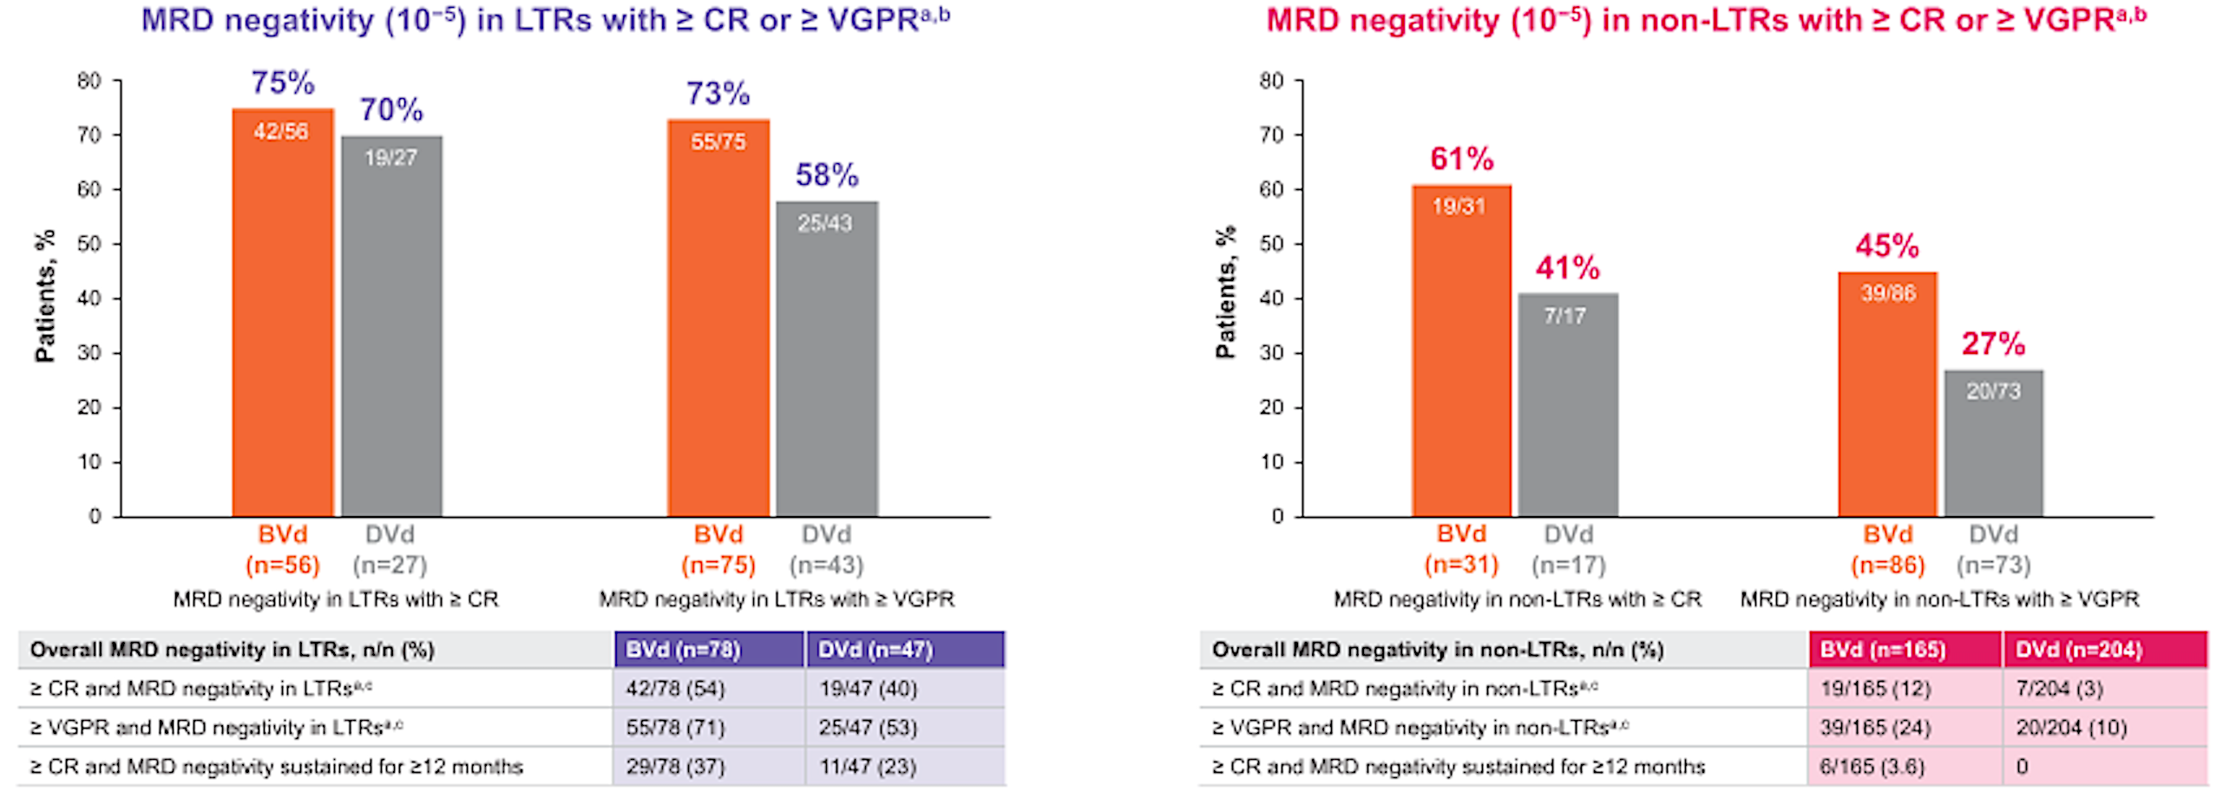
DREAMM-7: Minimal Residual Disease (MRD) Negativity in Long-Term Responders (LTRs) and Non-LTRs
Hungria V et al. ASH 2025;Abstract 7236.

Slide 59
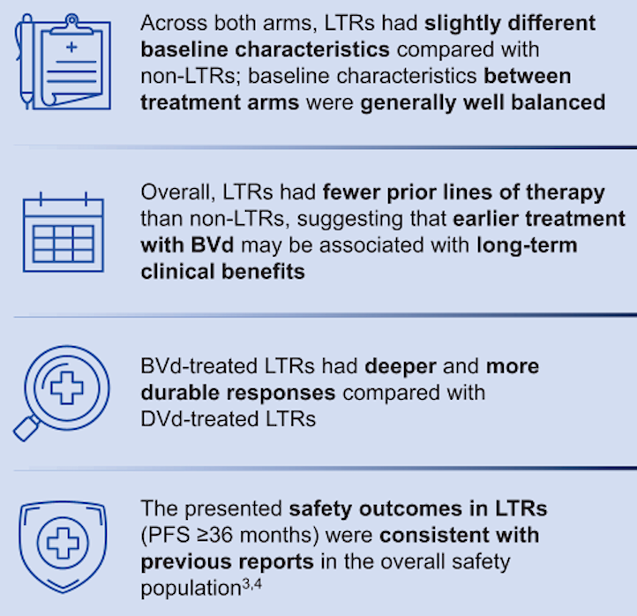
DREAMM-7: Authors’ Conclusions
Hungria V et al. ASH 2025;Abstract 7236.

Slide 60
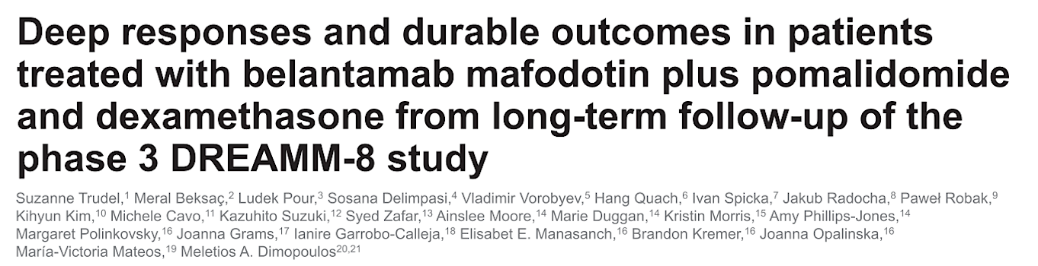
ASH 2025;Abstract 7677.

Slide 61
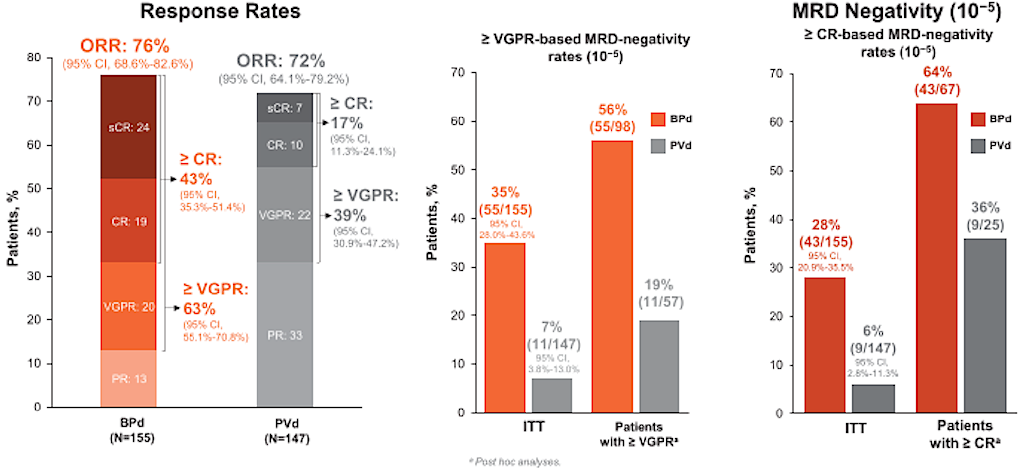
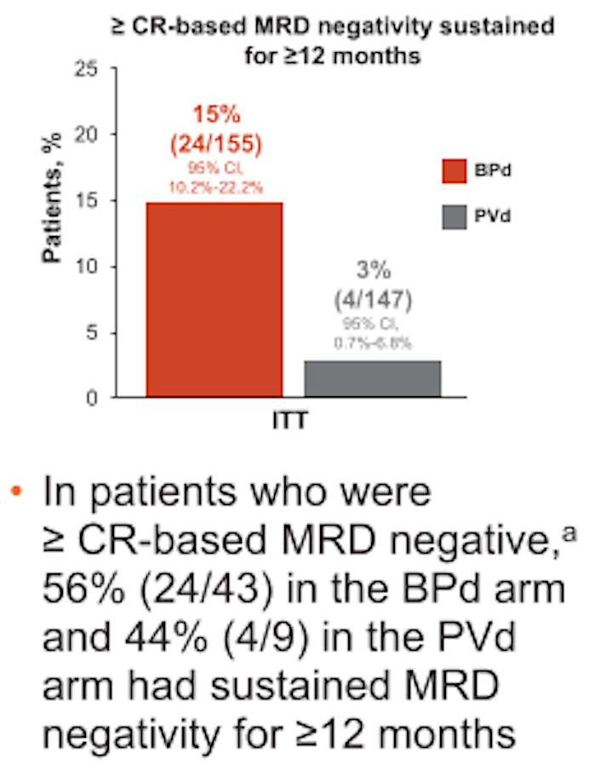
DREAMM-8 Long-Term Follow-Up: Response Rates and
MRD Negativity
BPd = belantamab mafodotin/pomalidomide/dexamethasone; PVd = pomalidomide/bortezomib/dexamethasone; ITT = intent to treat
Trudel S et al. ASH 2025;Abstract 7677.

Slide 62
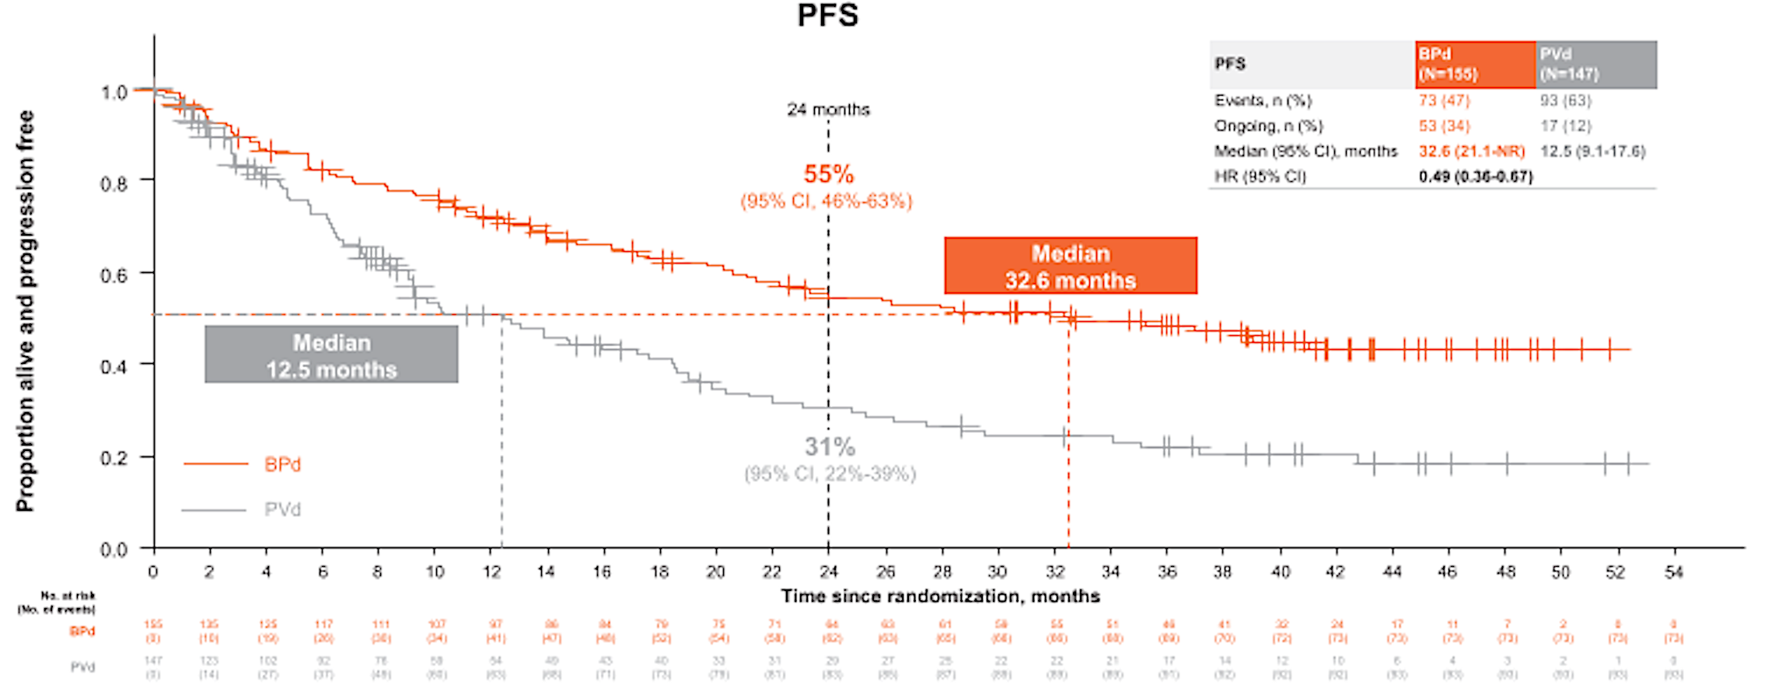
DREAMM-8 Long-Term Follow-Up: Progression-Free Survival (PFS)
Trudel S et al. ASH 2025;Abstract 7677.

Slide 63
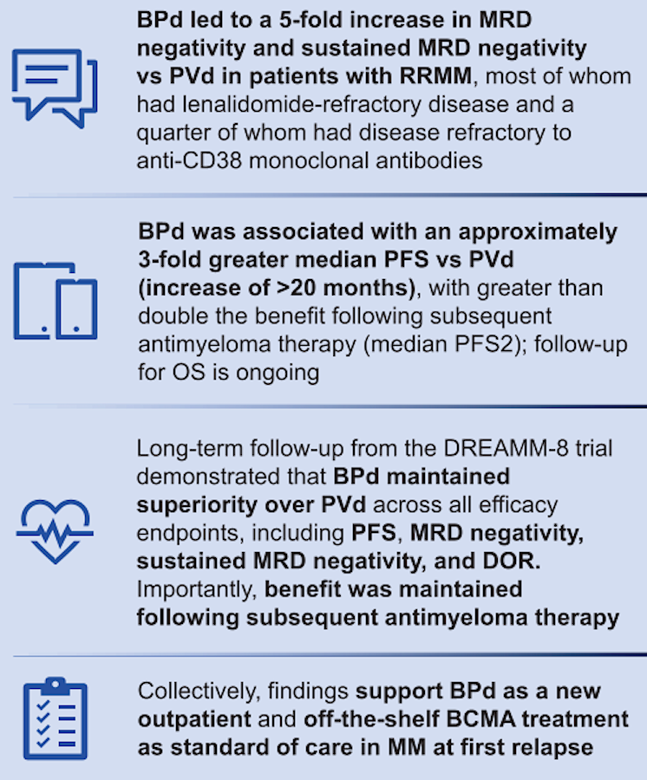
DREAMM-8: Authors’ Conclusions
DOR = duration of response
Trudel S et al. ASH 2025;Abstract 7677.

Slide 64
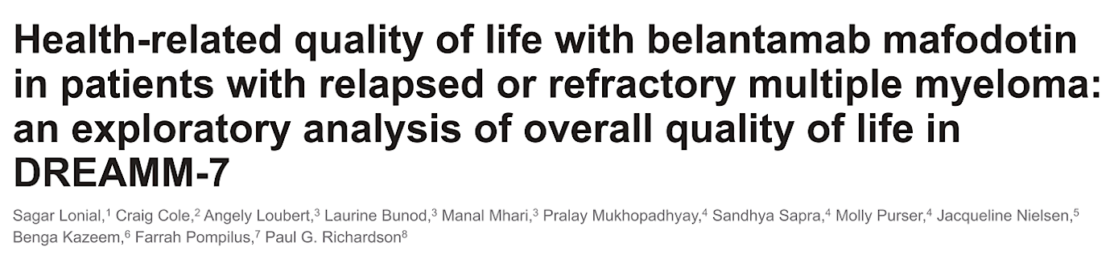
ASH 2025;Abstract 143.

Slide 65
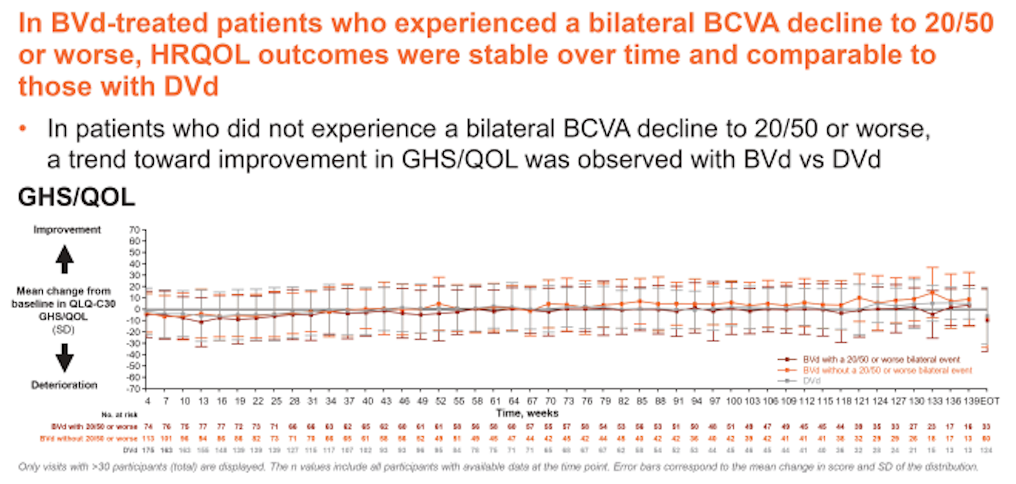
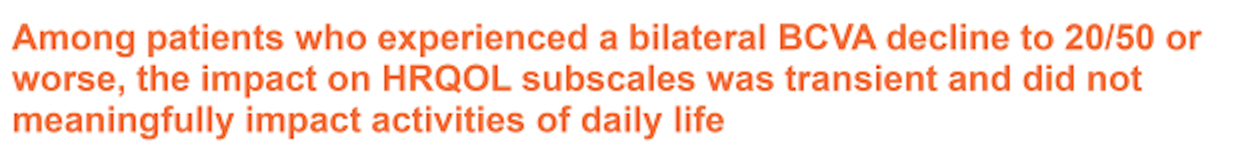
DREAMM-7 Exploratory Analysis: Global Health Status (GHS) and Quality of Life (QoL)
HRQOL = health-related quality of life; BCVA = best corrected visual acuity
Lonial S et al. ASH 2025;Abstract 143.

Slide 66
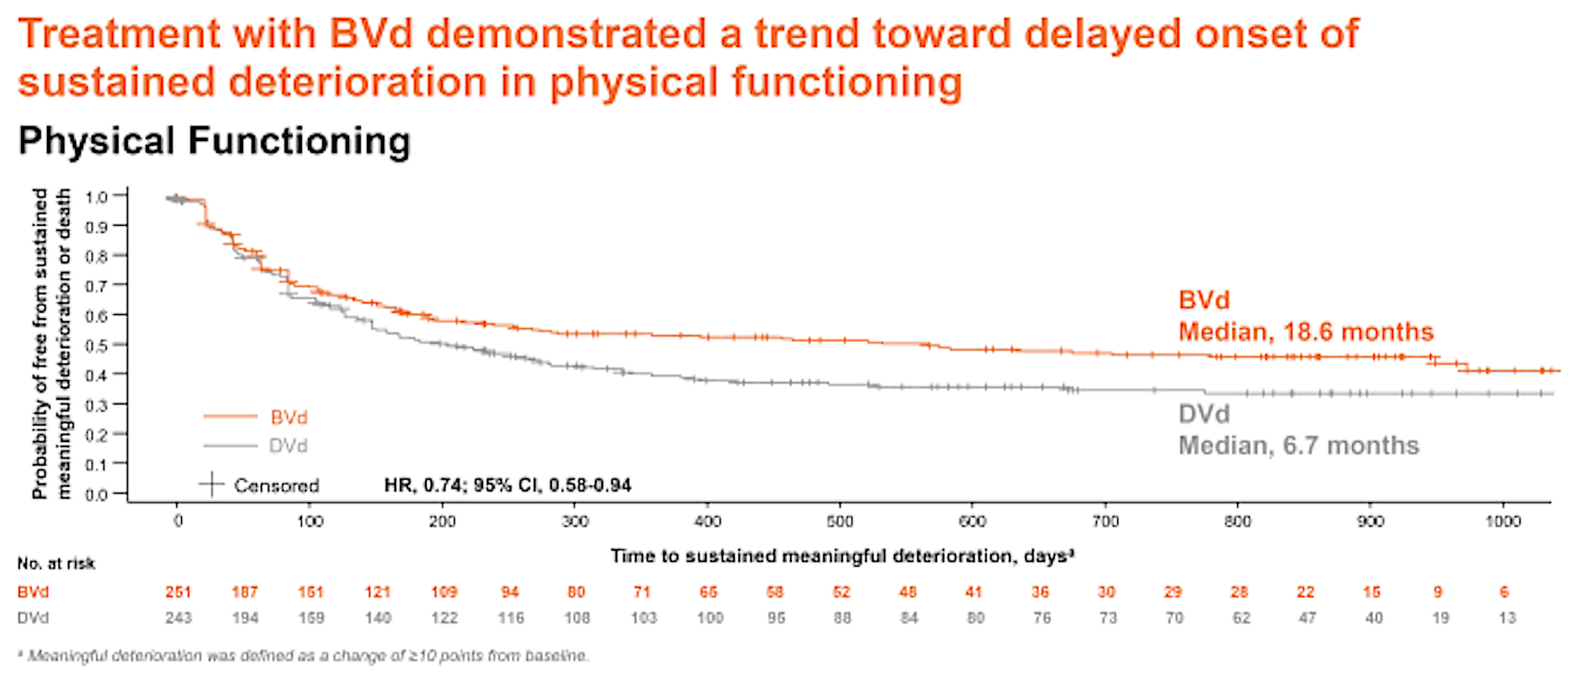
DREAMM-7 Exploratory Analysis: Treatment Benefit
A similar trend toward a delay in worsening of disease-specific symptoms was observed.
Lonial S et al. ASH 2025;Abstract 143.

Slide 67
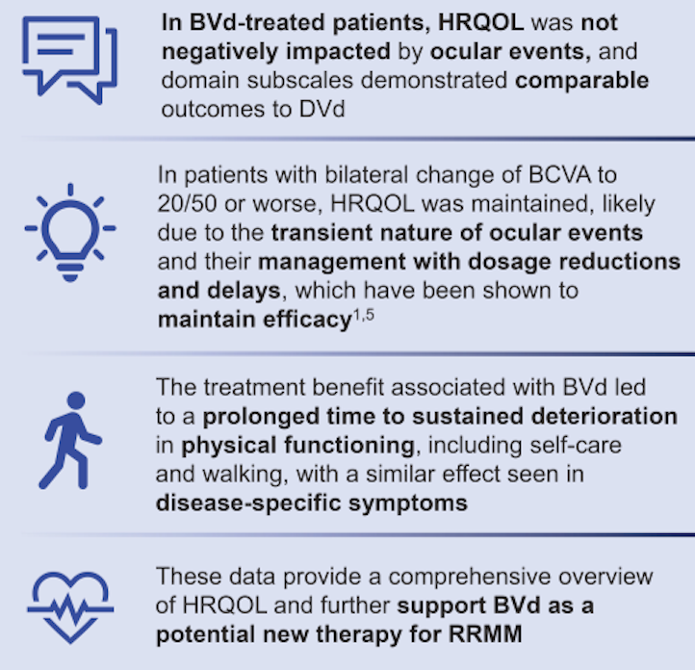
DREAMM-7 HRQoL: Authors’ Conclusions
NDMM = newly diagnosed multiple myeloma
Lonial S et al. ASH 2025;Abstract 143.

Slide 68
Belantamab Mafodotin (Belamaf) Ocular Events Are Manageable and Reversible With Dose Modifications Guided by Standard Assessments
Sagar Lonial,¹ Paul G. Richardson,² Craig E. Cole,³ Asim V. Farooq,⁴ Meghan Berkenstock,⁵ Julie Byrne,⁶ Sumita Roy-Ghanta,⁶ Rachel Rogers,⁶ Amy Phillips-Jones,⁷ Astrid McKeown,⁷ Natalie A. Afshari⁸
¹Winship Cancer Institute, Emory University Hospital, Atlanta, GA, USA; ²Dana-Farber Cancer Institute, Boston, MA, USA; ³Karmanos Cancer Institute, Wayne State University, Detroit, MI, USA, and Michigan State University, Lansing, MI, USA; ⁴University of Chicago Medical Center, Chicago, IL, USA; ⁵Johns Hopkins Wilmer Eye Institute, Baltimore, MD, USA; ⁶GSK, Collegeville, PA, USA; ⁷GSK, Stevenage, UK; ⁸ Shiley Eye Institute, Viterbi Family Department of Ophthalmology, University of California, San Diego, CA, USA
Corresponding author: Sagar Lonial, sloni01@emory.edu
Poster number 4055
Presented at 67th ASH Annual Meeting and Exposition | December 6-9, 2025 | Orlando, FL, USA

Slide 69
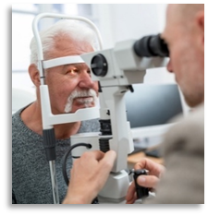
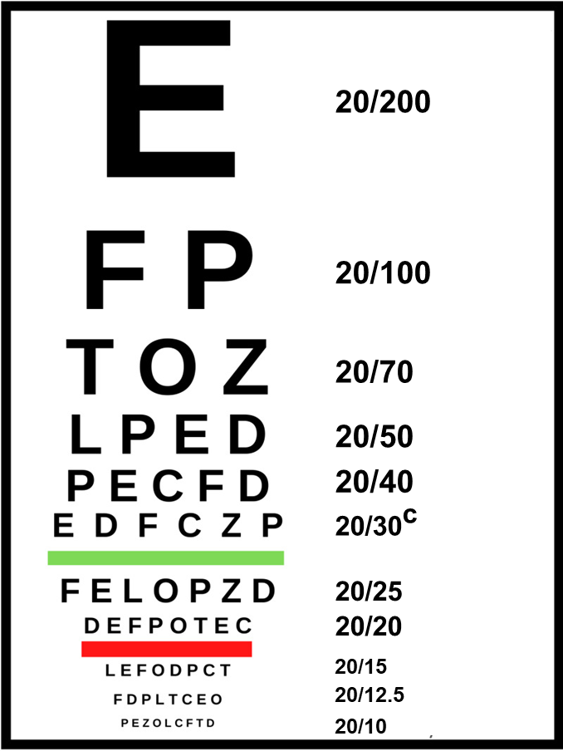
The KVA Scale Used to Grade OEFs Has a Sensitive Criteria for Belamaf Dose Modifications
Corneal exam finding
(slit lamp exam)ª
BCVA change
(Snellen or equivalent assessment)
Microcyst-like deposits
Representative Snellen Eye Chart^{b}
.
.
.
.
.
.
.
.
.
.
Grade 2 = eg, patchy microcyst-like deposits
Grade 2 = 2- or 3-line decrease in BCVA from baseline (eg, 20/20 to 20/30 or 20/40)
Dose delay until resolution to grade 1 or better^{d}
Dose delay until resolution to grade 1 or better^{e}
BCVA, best-corrected visual acuity; belamaf, belantamab mafodotin; KVA, Keratopathy and Visual Acuity; OEF, ocular exam finding.
ª The most common corneal exam findings in the trial were superficial punctate keratitis, microcyst-like changes, epithelial haze, and stromal opacity. ^{b} Not all distances are depicted here.
^{c} Included 20/30 or 20/32. ^{d} Mild superficial keratopathy. ^{e} Decline from baseline of 1 line on Snellen Visual Acuity.

Slide 70
Belamaf Dose Modifications Were Conservatively Guided by OEFs
Incidence and onset of events
DREAMM-7 (BVd, N=242)
Data cutoff: October 2, 2023
DREAMM-8 (BVd, N=150)
Data cutoff: January 29, 2024
OEF
Unilateral BCVAª
Bilateral BCVA
OEF
Unilateral BCVAª
Bilateral BCVA
n=209
n=131
Patients, %
n=166
Patients, %
n=108
n=82
n=51
Onset of the first event, median (range)
6 weeks
(2-87)
9 weeks
(2-132)
11 weeks
(2-108)
5 weeks
(3-76)
12 weeks
(3-109)
16 weeks
(4-109)
Last event resolved
42%
61%
83%
43%
60%
73%
Grade ≥2 OEFs had a higher incidence and earlier median time to onset than vision changes
BCVA, best-corrected visual acuity; belamaf, belantamab mafodotin; BVd, belantamab mafodotin, bortezomib, and dexamethasone; OEF, ocular exam finding.
ª Post hoc analyses.

Slide 71
Ocular Events Were Reversible in the Majority of Patients
Resolution of all occurrencesª
DREAMM-7 (BVd, N=242)
Data cutoff: October 2, 2023
DREAMM-8 (BVd, N=150)
Data cutoff: January 29, 2024
OEF
Unilateral BCVA
Bilateral BCVA
OEF
Unilateral BCVA
Bilateral BCVA
84%
607 of 724 occurrences resolved
84%
467 of 559 occurrences resolved^{b}
91%
137 of 151 occurrences resolved
76%
366 of 441
occurrences
resolved
81%
250 of 310
occurrences
resolved^{b}
83%
67 of 81 occurrences resolved
Time to resolution, median (range)
12 weeks
(0.7-116)
9 weeks
(0.4-129)
7 weeks
(1-130)
12 weeks
(2-107)
8 weeks
(0.7-124)
8 weeks
(2-64)
Improvement of
all events
94%
612 of 652 improved^{c}
96%
176 of 183 improved
91%
303 of 332 improved^{c}
89%
85 of 95 improved
NA
NA
Time to improvement, median (range)
3 weeks
(0.4-75)
3 weeks
(1-37)
4 weeks
(1-69)
4 weeks
(1-28)
NA
NA
Patients who experienced a bilateral worsening to 20/50 or worse did so for a median of 7% to 8% of their time on treatment
BCVA, best-corrected visual acuity; BVd, belantamab mafodotin, bortezomib, and dexamethasone; NA, not applicable; OEF, ocular exam finding.
ª Post hoc analysis. ^{b} For patients with baseline 20/50 or worse, resolution must additionally be better than 20/50. ^{c} Only patients with baseline visual acuity better than 20/50 in ≥1 eye are included.

Slide 72
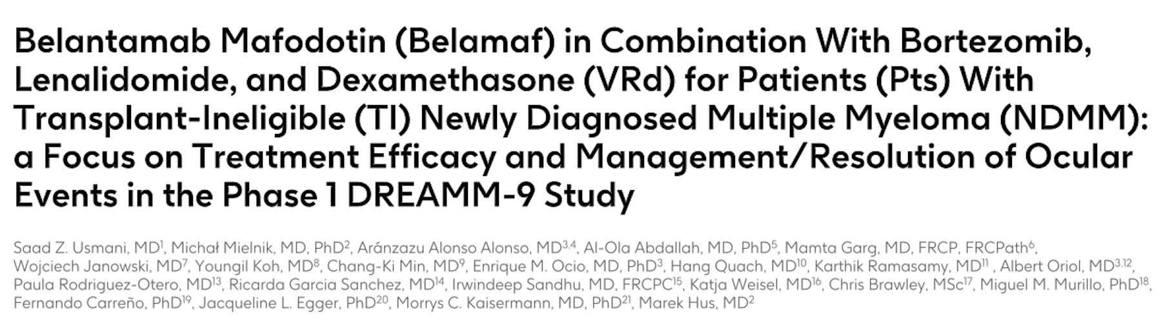
ASH 2025;Abstract 13646.

Slide 73
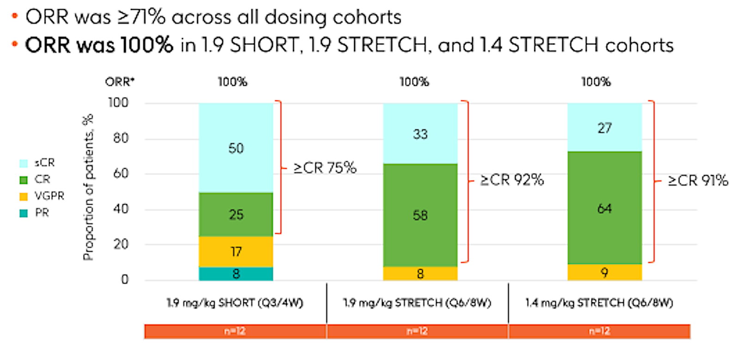
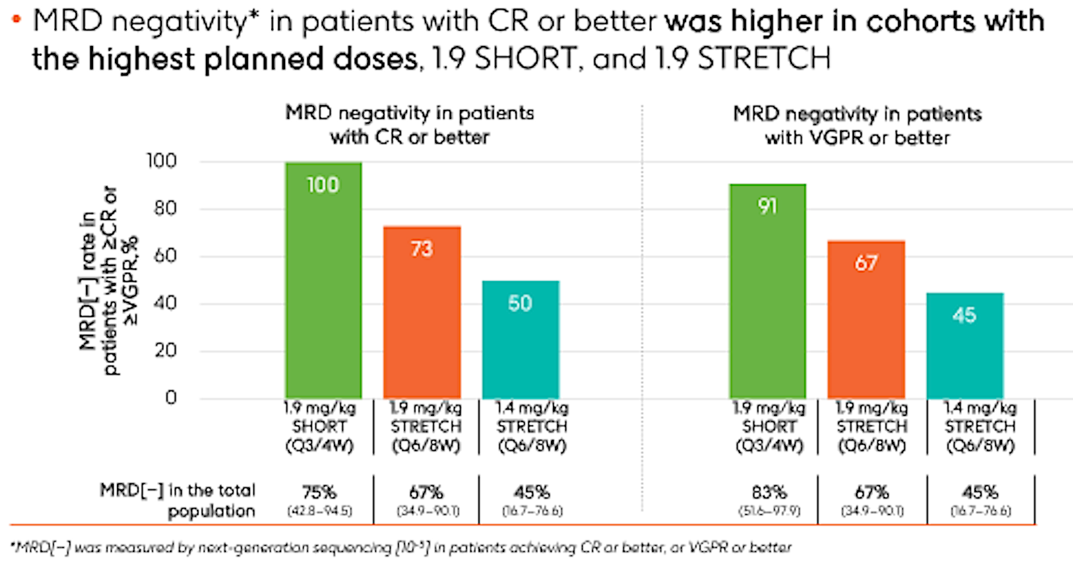
DREAMM-9 Efficacy: Overall Response Rate (ORR) and MRD Negativity Rates
Usmani SZ et al. ASH 2025;Abstract 13646.

Slide 74
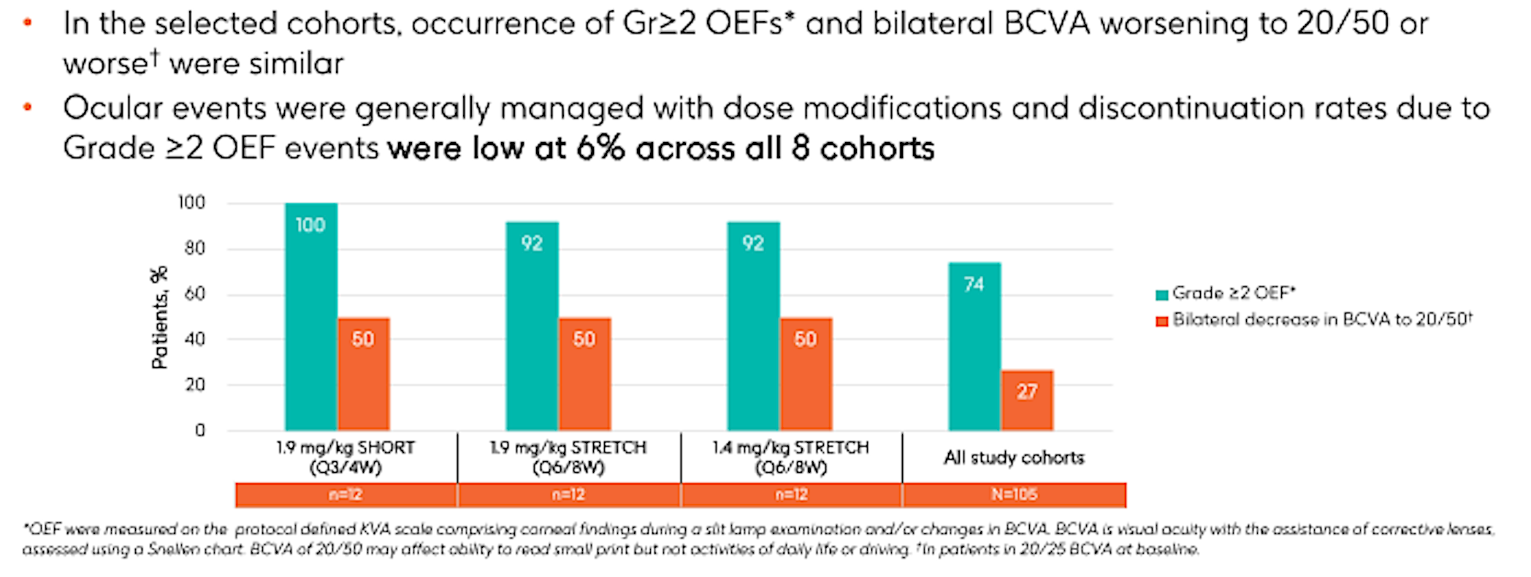
DREAMM-9 Efficacy: Ocular Event Findings (OEFs)
Usmani SZ et al. ASH 2025;Abstract 13646.

Slide 75
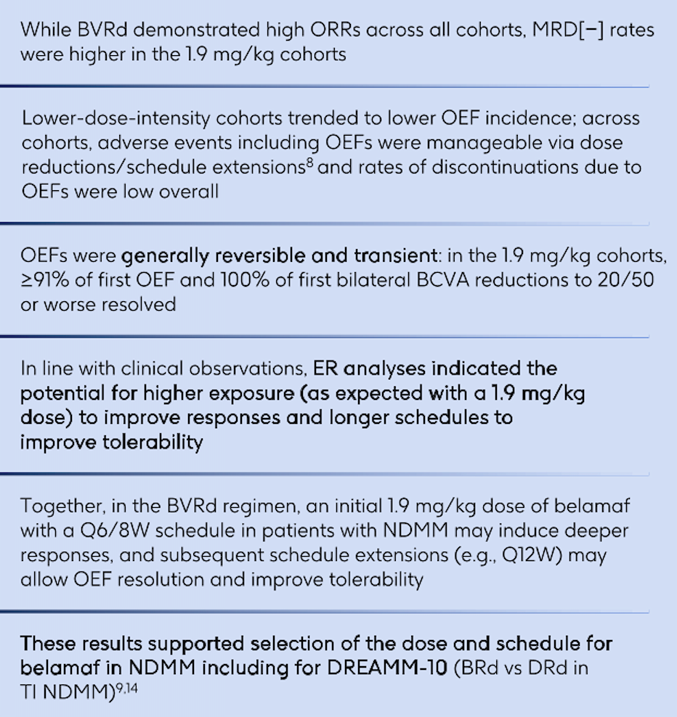
DREAMM-9: Authors’ Conclusions
NDMM = newly diagnosed multiple myeloma
Usmani SZ et al. ASH 2025;Abstract 13646.

Slide 76
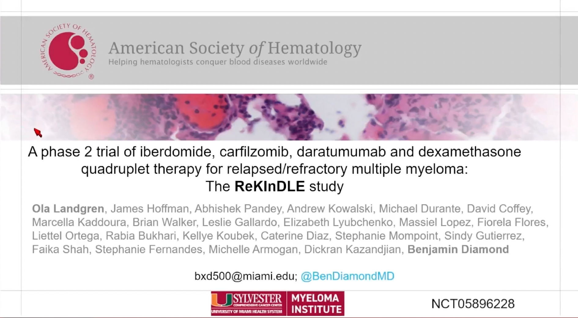
ASH 2025;Abstract 4108.

Slide 77
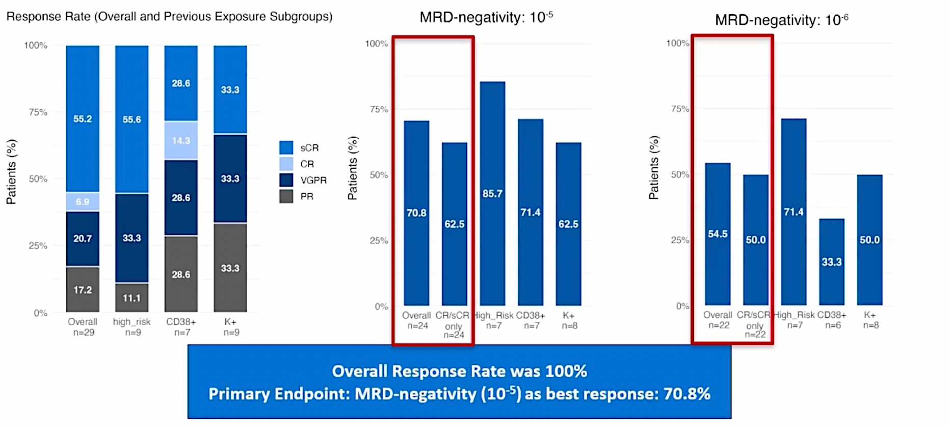
ReKInDLE: Response Rates and MRD Analysis
Landgren O et al. ASH 2025;Abstract 4108.

Slide 78
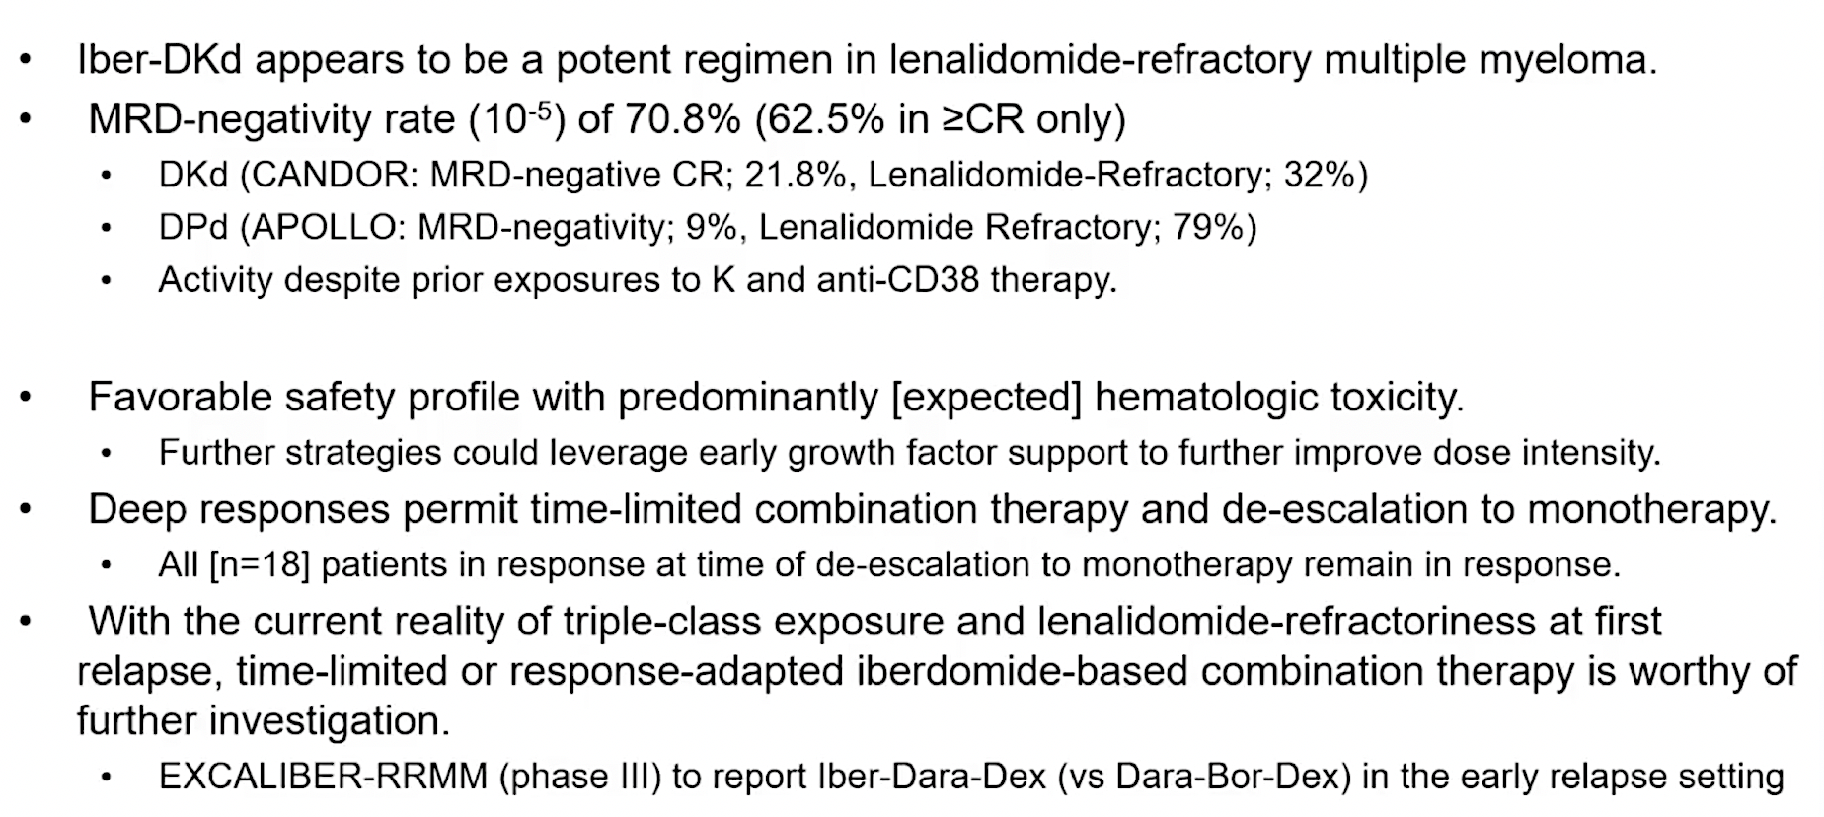
ReKInDLE: Authors’ Conclusions
DKd = daratumumab/carfilzomib/dexamethasone
Landgren O et al. ASH 2025;Abstract 4108.

Slide 79
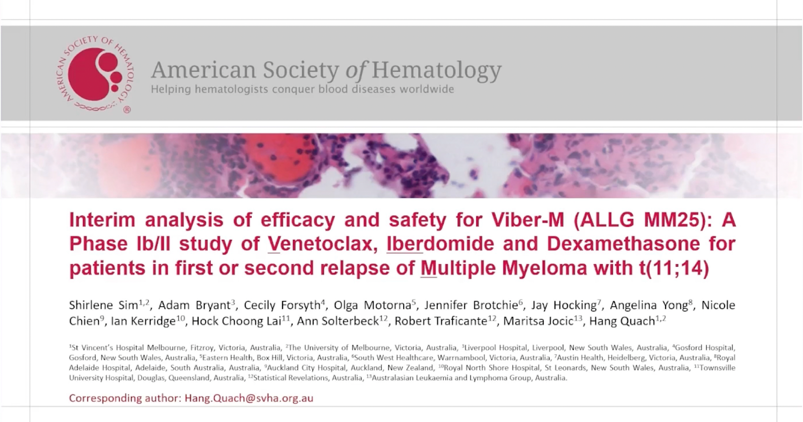
ASH 2025;Abstract 7320.

Slide 80

Viber-M (ALLG MM25): Response at the End of Cycle 3
Sim S et al. ASH 2025;Abstract 7320.

Slide 81

Viber-M (ALLG MM25): Authors’ Conclusions
Sim S et al. ASH 2025;Abstract 7320.

Slide 82


Slide 83
MagnetisMM-30 Study Design
MagnetisMM-30 (NCT06215118) is a phase 1b, open-label, multicenter, prospective study
Part 1 (dose escalation) primary objective was to assess the tolerability and safety of elranatamab in combination with iberdomide to determine the recommended doses of the combination for evaluation in Part 2 (randomized dose optimization)
  A BOIN approach was used to guide dose escalation/de-escalation in Part 1
Patients with RRMM
Elranatamab 76 mg Q2W
+ iberdomide 1.3 mg QD
Elranatamab 76 mg QW
+ iberdomide 1.0 mg QD
Dose Level 2
Dose Level 1^{b}
Primary endpoint
Key inclusion criteria
Age ≥18 years with MM per IMWG criteria
ECOG PS 0-1
2-4 prior LOTs, including ≥1 IMiD and ≥1 PIª
Relapsed or refractory to last LOT
Key exclusion criterion
    Stem cell transplant ≤12 weeks prior to enrollment or active GVHD
    Ongoing grade ≥2 peripheral sensory or motor neuropathy; history of grade ≥3 peripheral motor polyneuropathy
DLTs during DLT observation period
Secondary endpoints
AEs and laboratory abnormalities
ORR^{c}
CR rate^{c}
Time-to-event endpoints^{c}
PK
MRD negativity rate^{c}
Immunogenicity
Elranatamab 76 mg Q2W
+ iberdomide 1.0 mg QD
Dose Level –1^{b}
Dose Level –2
Elranatamab 76 mg Q2W
+ iberdomide 0.75 mg QD
ª All patients must have received ≥2 consecutive cycles of an IMiD-containing regimen and ≥2 consecutive cycles of a PI or PI-containing regimen; ^{b} All patients received an initial 14-day cycle of elranatamab (12 mg on day 1, 32 mg on day 4, 76 mg on day 8) without iberdomide. Iberdomide was dosed at 21 out of 28 days for subsequent cycles; ^{c} Per IMWG criteria
AE=adverse event; BOIN=Bayesian Optimal Interval Design; CR rate=complete response rate; DLT=dose-limiting toxicity; ECOG PS=Eastern Cooperative Oncology Group performance status; GVHD=graft vs host disease; IMiD=immunomodulatory drug; IMWG=International Myeloma Working Group; LOT=line of therapy; MM=multiple myeloma; MRD=minimal residual disease; ORR=objective response rate; PI=proteasome inhibitor; PK=pharmacokinetics; QD=once daily; QW=once weekly; Q2W=once every 2 weeks

Slide 84
ORR
 | DL1 76 mg ELRA QW + 1.0 mg IBER | DL–1 76 mg ELRA Q2W + 1.0 mg IBER | Overall
Median follow-upª | 9.4 months (range, 0.7-11.3) | 5.2 months (range, 4.5-6.4) | 7.8 months (range, 0.7-11.3)
Overall, the confirmed ORR by investigator was 95.5% (95% CI, 77.2-99.9)
Responses occurred early
  Median time to response was
  1.4 months (range, 0.5-2.7)
ORR, 100.0%
(95% CI, 66.4-100.0)
ORR, 92.3%
(95% CI, 64.0-99.8)
ORR, 95.5%
(95% CI, 77.2-99.9)
≥CR:
44.4%
≥CR:
46.2%
≥CR:
45.5%
≥VGPR:
69.2%
≥VGPR:
88.9%
≥VGPR:
77.3%
ª Simple median of observation times.
CR=complete response; DL=dose level; ELRA=elranatamab; IBER=iberdomide; ORR=objective response rate; PR=partial response; sCR=stringent complete response; VGPR=very good partial response

Slide 85
Swimmer Plot: Response and PFS per investigator
sCR
CR
DL1
(n=13)
DL–1
(n=9)
VGPR
Confirmed BOR
(per IMWG)
PR
MR
SD
NE
NA
Ongoing treatment
Death
Time from initial dose, months
Time from initial dose, months
EOT due to AE
EOT due to PD
0
1
2
3
4
5
6
7
8
9
10
11
0
1
2
3
4
5
6
7
8
9
10
11
Grade 5 treatment-emergent adverse events were progressive disease and pancreatic cancer (patient died with VGPR).
AE=adverse event; BOR=best overall response; CR=complete response; DL=dose level; IMWG=International Myeloma Working Group; EOT=end of treatment; MR=minimal response; NA=not assessed; NE=not evaluable; PD=progressive disease; PR=partial response; sCR=stringent complete response; SD=stable disease; VGPR=very good partial response

Slide 86
Agenda
Introduction | Dr Yannucci – 60-year-old man | Best of ASH Multiple Myeloma
Case 1 | Dr Morganstein – 62-year-old man | Dr Lorber – 59-year-old man
Faculty Presentation: Antibody-Drug Conjugates and Other Emerging Novel Therapies for Relapsed/Refractory (R/R) Multiple Myeloma (MM) — Dr Lonial
Case 2 | Dr Morganstein – 84-year-old man
Case 3 | Dr Favaro – 64-year-old man
Case 4 | Dr Bhatnager – 71-year-old man
Case 5 | Dr Lee – 71-year-old man
Faculty Presentation: Integrating CAR T-Cell Therapy and Bispecific Antibodies into the Management of R/R MM — Dr Mateos
Case 6 | Dr Rudolph – 56-year-old man

Slide 87
Case Presentation: 84-year-old morbidly obese man with CAD, CHF and sleep apnea with multiregimen-relapsed myeloma eventually, as part of expanded access, receives belantamab mafodotin with low-dose pomalidomide
Dr Neil Morganstein (Summit, New Jersey)

Slide 88
Agenda
Introduction | Dr Yannucci – 60-year-old man | Best of ASH Multiple Myeloma
Case 1 | Dr Morganstein – 62-year-old man | Dr Lorber – 59-year-old man
Faculty Presentation: Antibody-Drug Conjugates and Other Emerging Novel Therapies for Relapsed/Refractory (R/R) Multiple Myeloma (MM) — Dr Lonial
Case 2 | Dr Morganstein – 84-year-old man
Case 3 | Dr Favaro – 64-year-old man
Case 4 | Dr Bhatnager – 71-year-old man
Case 5 | Dr Lee – 71-year-old man
Faculty Presentation: Integrating CAR T-Cell Therapy and Bispecific Antibodies into the Management of R/R MM — Dr Mateos
Case 6 | Dr Rudolph – 56-year-old man

Slide 89
Case Presentation: 64-year-old man s/p CVA with aphasia who has multiregimen-relapsed MM after daratumumab, PIs, IMIDs and selinexor receives teclistamab
Dr Justin Favaro
(Charlotte, North Carolina)
Questions for the faculty
Dr Priya Rudolph
(Athens, Georgia)

Slide 90
Agenda
Introduction | Dr Yannucci – 60-year-old man | Best of ASH Multiple Myeloma
Case 1 | Dr Morganstein – 62-year-old man | Dr Lorber – 59-year-old man
Faculty Presentation: Antibody-Drug Conjugates and Other Emerging Novel Therapies for Relapsed/Refractory (R/R) Multiple Myeloma (MM) — Dr Lonial
Case 2 | Dr Morganstein – 84-year-old man
Case 3 | Dr Favaro – 64-year-old man
Case 4 | Dr Bhatnager – 71-year-old man
Case 5 | Dr Lee – 71-year-old man
Faculty Presentation: Integrating CAR T-Cell Therapy and Bispecific Antibodies into the Management of R/R MM — Dr Mateos
Case 6 | Dr Rudolph – 56-year-old man

Slide 91
Case Presentation: 71-year-old man with kappa light chain myeloma experiences CR on cilta-cel CAR T-cell therapy with hypogammaglobulinemia requiring IVIG, develops melanoma of the abdominal wall
Dr Tina Bhatnagar (Wheeling, West Virginia)

Slide 92
Agenda
Introduction | Dr Yannucci – 60-year-old man | Best of ASH Multiple Myeloma
Case 1 | Dr Morganstein – 62-year-old man | Dr Lorber – 59-year-old man
Faculty Presentation: Antibody-Drug Conjugates and Other Emerging Novel Therapies for Relapsed/Refractory (R/R) Multiple Myeloma (MM) — Dr Lonial
Case 2 | Dr Morganstein – 84-year-old man
Case 3 | Dr Favaro – 64-year-old man
Case 4 | Dr Bhatnager – 71-year-old man
Case 5 | Dr Lee – 71-year-old man
Faculty Presentation: Integrating CAR T-Cell Therapy and Bispecific Antibodies into the Management of R/R MM — Dr Mateos
Case 6 | Dr Rudolph – 56-year-old man

Slide 93
Case Presentation: 71-year-old man with light chain MM receives daratumumab/RVd with VGPR, subsequently completes ASCT ➔ maintenance ixazomib and 2 years later is diagnosed with locally advanced prostate cancer treated with radiation therapy and ADT. Now with myeloma progression
Dr Eric Lee (Fountain Valley, California)

Slide 94
Agenda
Introduction | Dr Yannucci – 60-year-old man | Best of ASH Multiple Myeloma
Case 1 | Dr Morganstein – 62-year-old man | Dr Lorber – 59-year-old man
Faculty Presentation: Antibody-Drug Conjugates and Other Emerging Novel Therapies for Relapsed/Refractory (R/R) Multiple Myeloma (MM) — Dr Lonial
Case 2 | Dr Morganstein – 84-year-old man
Case 3 | Dr Favaro – 64-year-old man
Case 4 | Dr Bhatnager – 71-year-old man
Case 5 | Dr Lee – 71-year-old man
Faculty Presentation: Integrating CAR T-Cell Therapy and Bispecific Antibodies into the Management of R/R MM — Dr Mateos
Case 6 | Dr Rudolph – 56-year-old man

Slide 95




Integrating CAR-T cell therapy and BsAbs into the management of RRMM patients
University of Salamanca
María-Victoria Mateos
Salamanca, Spain

Slide 96
Treatment landscape in Multiple Myeloma today: realistic situation
1st line
ASCT eligible
ASCT ineligible
AntiCD38 + PI + IMiD + Dex
ASCT
Len/Dara-Len
Dara-Len-dex
Dara-VMP/RVd
AntiCD38 + PI + IMiD + Dex
2nd line
Based on sensitivity/refractoriness to Daratumumab and Lenalidomide
Anti-CD38 + Carfilzomib-dex
Anti-CD38 + Pomalidomide-dex
Pomalidomide-bortezomib-dex
Selinexor-bortezomib-dex
Carfilzomib-dex
3rd line
4th line
Anti-CD38 + Pomalidomide-dex
Elotuzumab-Pomalidomide-dex
Previous combos if pt eligible
BCMA-targeted therapy
GPRC5D-targeted therapy
Talquetamab
Ide-cel
Cilta-cel
BsAbs
CAR-T
The label is for RRMM after at least 4 PL of therapy
including PI, IMiD and antiCD38 and refractory
to the last line of therapy
Teclistamab, Elranatamab
Linvoseltamab
BsAbs
Mateos MV, personal communication. Dimopoulos MA et al. EHA/ESMO guidelines. Annals of Oncology 2021

Slide 97
Phase 2 Registrational Study of Anitocabtagene Autoleucel for the Treatment of Patients with (RRMM): Updated Results from iMMagine-1
Anito-cel is an autologous BCMA-directed CAR T-cell therapy using a novel D-Domain binder
117 TCE RRMM pts were dosed: median age 64; 18% EMD; 18% high tumor burden and 40% HRCA
Median number of PL: 3, TCR 87% and PCR 41%. 76% received bridging therapy. Median f/u: 16 months
Safety profile: CRS in 85% (G1 in 68% and G2 in 17); ICANS in 8%
No delayed NT; no SPM; no enterocolitis
G3-4 neutropenia: 70% and G3-4 infections: 9%
Patel K et al: ASH 2025: oral presentation. Abstract number 256

Slide 98



KarMMa-3: Ide-cel in RRMM after 2-4PL: outcomes in the older population
20% of pts approximately were older than 70 years
Patients older than 70 years were, overall: with less HRCA, less TCR and with longer time from the last line of therapy
Conclusions:
Patients aged ≥ 70 years from the KarMMa-3 trial experienced benefit from ide-cel treatment, as evidenced by a longer median PFS and notable ORR compared with patients treated with standard regimens
Ailawadhi S et al. ASH 2025: poster presentation number 9044

Slide 99
What is the subgroup of patients treated with Cilta-cel in C4 with better outcomes?
Safety profile of cilta-cel in standard-risk population was consistent with overall study population^{1,b}
Costa L et al. ASH 2025: oral presentation: abstract number 9129

Slide 100
The better outcomes for standard risk patients in C4 are applicable to C1
 | 30-month PFS rate, % | 30-month OS rate, %
CARTITUDE-4 (median 2 prior lines) 59.4% 76.4%
Cilta-cel Standard-risk cytogenetics per protocol | 80.5 | 87.3
Cilta-cel Standard-risk cytogenetics per protocol + gain/amp(1q) | 71.7 | 86.1
CARTITUDE-1 (median 6 prior lines) Median PFS 36 m and OS 60 m
Cilta-cel Standard-risk cytogenetics per protocol including gain/amp(1q) | 59.9 | 70.6
Costa L et al. ASH 2025: oral presentation: abstract number 9129

Slide 101


Earlier use of Cilta-cel is associated with better immune fitness and stronger immune effects
Cilta-cel in both C1 and C4 trials showed better outcomes in earlier lines of therapy (especially after 1 or 2 PL)
Evaluation included PB samples at D28 and M6: - Bulk RNA sequencing
                - TCR repertoire in C-1
                - Immunophenotyping by FCM
Cartitude-4
Parek S et al. ASH 2025: oral presentation. abstract number 8211

Slide 102



Earlier use of Cilta-cel is associated with better immune fitness and stronger immune effects
Cartitude-1: 33% of pts remain alive and progression-free at 5 years
Cartitude-4
Parek S et al. ASH 2025: oral presentation. abstract number 8211

Slide 103
Teclistamab-Talquetamab in RRMM patients: phase 1b of RedirecTT-1 trial
94 pts overall and 43 at the RP2R were included. Median number of PL: 4 (86% TCR and 46% with true EMD)
Safety profile: Infections are the most relevant ones (43% G3-4 at the RP2R); opportunistic infections in 17% of pts; any-grade infection risk peaked early and stabilized by ~6 months; grade ≥3 infection risk was highest in the first 6 months and decreased over time
On target off tumor toxicity related with GPRC5D are frequent but most are G1-2
Tec-Tal today has a role in patients with true EMD because this population has an unmet need.
MonumenTAL-9 study will confirm its role in all RRMM patients
Mateos MV et al. ASH 2025: oral presentation. Abstract number 7712

Slide 104


Subcutaneous Cevostamab (a novel FcRH5xCD3 bispecific T-cell engager — BiTE) in RRMM patients: Phase Ib CAMMA 3 study
58 pts included. Median number of PL: 5 (64% TCR and 48.3% BCMA-TT exposed including CAR-T, ADC and BsAbs)
Cevostamab was evaluated at different doses and dose > 120 mg is effective. Fixed duration: 13 c
Safety profile: Infections (44.8% and G3-4 12%); CRS in 69% and injection-site reaction in 58.6%; neutropenia in 31% (most G3-4)
The role of Cevostamab is interesting for the sequencing of T-cell redirecting therapies but.. more data are required and its role is maybe in combination
Ho PJ et al. ASH 2025: oral presentation: abstract number 8172

Slide 105


Etentamig (BCMAxCD3 BiTE) plus Pom-dex in RRMM patients: Cohort A of the clinical trial
85 pts included. Median number of PL: 4 (73% TCR and 51% refractory to pomalidomide)
Etentamig was given in this cohort with no SUD, no premedication and Q4W
Pom and dex at conventional doses from C1D1 and dose for etentamig was 20 or 40 mg
Safety profile: Infections (89% and G3-4 52%); CRS in 35% (no G3-4); neutropenia G3-4 in 78%. Hepatic toxicity in 25% (G3-4 in 8%)
Cohort E included some modifications: SUD 1 and Pom included at C2D1. Dose of etentamig 60 mg and less pretreated but the f/u was short
Voorhees P et al. ASH 2025: oral presentation: abstract number 1875

Slide 106



Ramantamig, BCMA-GPRC5D trispecific mAB in RRMM patients
36 pts received ramantamig at the RP2D (1 SUD followed by 100 mg flat dose Q4W). Median number of 4 PL (53% TCR and 25% previously exposed to BCMA/GPRc5D)
Ramantamig has a great efficacy in patients naïve to T-Cell Redirecting therapy similar to CAR-T
It is pending to know the activity in patients previously exposed as well as in specific populations like patients with EMD
Krishnan AY et al. ASH 2025: poster presentation. Abstract number 7875

Slide 107




Low dose Tocilizumab for mitigation of CRS with BsAbs in RRMM
Prophylactic single Toci-lo proved to be an effective strategy at reducing CRS incidence and severity during the SUD phase of BsAbs treatment. This low dose instead of the standard (8 mg/kg) may be a cost-effective strategy.
Hamadeh I et al. ASH 2025: poster presentation: abstract number 7258

Slide 108
Agenda
Introduction | Dr Yannucci – 60-year-old man | Best of ASH Multiple Myeloma
Case 1 | Dr Morganstein – 62-year-old man | Dr Lorber – 59-year-old man
Faculty Presentation: Antibody-Drug Conjugates and Other Emerging Novel Therapies for Relapsed/Refractory (R/R) Multiple Myeloma (MM) — Dr Lonial
Case 2 | Dr Morganstein – 84-year-old man
Case 3 | Dr Favaro – 64-year-old man
Case 4 | Dr Bhatnager – 71-year-old man
Case 5 | Dr Lee – 71-year-old man
Faculty Presentation: Integrating CAR T-Cell Therapy and Bispecific Antibodies into the Management of R/R MM — Dr Mateos
Case 6 | Dr Rudolph – 56-year-old man

Slide 109
Case Presentation: 56-year-old man with heavily relapsed MM who received multiple prior lines of therapy, including CAR T-cell therapy, is now on talquetamab
Dr Priya Rudolph (Athens, Georgia)

Slide 110
Contributing General Medical Oncologists
Warren S Brenner, MD
Lynn Cancer Institute
Boca Raton, Florida
Jeremy Lorber, MD
Cedars-Sinai Medical Center
Beverly Hills, California
Bhavana (Tina) Bhatnagar, DO WVU Cancer Institute
Wheeling, West Virginia
Neil Morganstein, MD
Atlantic Health System
Summit, New Jersey
Justin Favaro, MD, PhD
Oncology Specialists of Charlotte
Charlotte, North Carolina
Priya Rudolph, MD, PhD
Georgia Cancer Specialists
Athens, Georgia
Eric H Lee, MD, PhD
Los Angeles Cancer Network
Fountain Valley, California

Slide 111
Practical Perspectives on the Current and Future Management of Immune Thrombocytopenia — What Happened at ASH 2025?
A CME/MOC-Accredited Live Webinar
Tuesday, December 16, 2025
5:00 PM – 6:30 PM ET
Faculty
Hanny Al-Samkari, MD
Cindy Neunert, MD, MSCS
Professor Francesco Zaja
Moderator
Neil Love, MD

Slide 112
Thank you for joining us!
Please take a moment to complete the survey currently up on Zoom. Your feedback is very important to us.
The survey will remain open for
5 minutes after the meeting ends.
Information on how to obtain CME and ABIM MOC credit is provided in the Zoom chat room.
Attendees will also receive an email in 1 to 3 business days with these instructions.

