Slide 1
Practical Perspectives on the Current Role of Bispecific Antibodies in the Management of Lymphoma — What Happened at ASH 2025?
A CME/MOC-Accredited Live Webinar
Wednesday, December 17, 2025 5:00 PM – 6:00 PM ET
Faculty
Michael Dickinson, MD
Laurie H Sehn, MD, MPH
Moderator
Neil Love, MD

Slide 2
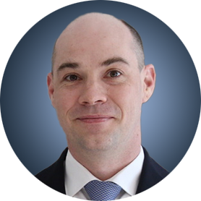
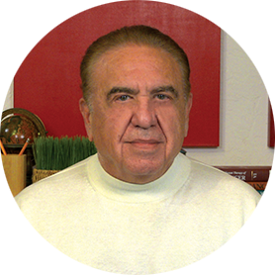
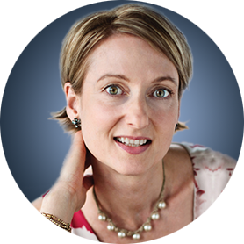
Faculty
Michael Dickinson, MD
Hematologist
Lead of Aggressive Lymphoma
Peter MacCallum Cancer Centre
and Royal Melbourne Hospital
Melbourne, Australia
MODERATOR
Neil Love, MD Research To Practice Miami, Florida
Laurie H Sehn, MD, MPH
Chair, Lymphoma Tumour Group
BC Cancer Centre for Lymphoid Cancer
Clinical Professor of Medicine
The University of British Columbia
Vancouver, British Columbia, Canada

Slide 3
Commercial Support
This activity is supported by an educational grant from Genentech, a member of the Roche Group.

Slide 4
Dr Love — Disclosures
Dr Love is president and CEO of Research To Practice. Research To Practice receives funds in the form of educational grants to develop CME activities from the following companies: Aadi Bioscience, AbbVie Inc, ADC Therapeutics, Agendia Inc, Alexion Pharmaceuticals, Amgen Inc, Array BioPharma Inc, a subsidiary of Pfizer Inc, Arvinas, Astellas, AstraZeneca Pharmaceuticals LP, Aveo Pharmaceuticals, Bayer HealthCare Pharmaceuticals, BeOne, Biotheranostics Inc, A Hologic Company, Black Diamond Therapeutics Inc, Blueprint Medicines, Boehringer Ingelheim Pharmaceuticals Inc, Bristol Myers Squibb, Celcuity, Clovis Oncology, Coherus BioSciences, Corcept Therapeutics Inc, CTI BioPharma, a Sobi Company, Daiichi Sankyo Inc, Eisai Inc, Elevation Oncology Inc, Exact Sciences Corporation, Exelixis Inc, Genentech, a member of the Roche Group, Genmab US Inc, Geron Corporation, Gilead Sciences Inc, GSK, Helsinn Therapeutics (US) Inc, ImmunoGen Inc, Incyte Corporation, Ipsen Biopharmaceuticals Inc, Jazz Pharmaceuticals Inc, Johnson & Johnson, Karyopharm Therapeutics, Kite, A Gilead Company, Kura Oncology, Legend Biotech, Lilly, MEI Pharma Inc, Merck, Mersana Therapeutics Inc, Mirati Therapeutics Inc, Mural Oncology Inc, Natera Inc, Novartis, Novartis Pharmaceuticals Corporation on behalf of Advanced Accelerator Applications, Novocure Inc, Nuvalent, Pfizer Inc, Pharmacyclics LLC, an AbbVie Company, Puma Biotechnology Inc, Regeneron Pharmaceuticals Inc, Rigel Pharmaceuticals Inc, R-Pharm US, Sanofi, Seagen Inc, Servier Pharmaceuticals LLC, SpringWorks Therapeutics Inc, Stemline Therapeutics Inc, Sumitomo Pharma America, Syndax Pharmaceuticals, Taiho Oncology Inc, Takeda Pharmaceuticals USA Inc, TerSera Therapeutics LLC, and Tesaro, A GSK Company.

Slide 5
Research To Practice CME Planning Committee Members, Staff and Reviewers
Planners, scientific staff and independent reviewers for Research To Practice have no relevant conflicts of interest to disclose.

Slide 6
Prof Dickinson — Disclosures
Advisory Committees | AbbVie Inc, Bristol Myers Squibb, Genmab US Inc, Gilead Sciences Inc, Kite, A Gilead Company, Lilly, MSD, Novartis, Roche Laboratories Inc
Consulting Agreements | AbbVie Inc, Arvinas, Bristol Myers Squibb, Genmab US Inc, Gilead Sciences Inc, Kite, A Gilead Company, Lilly, MSD, Novartis, Roche Laboratories Inc

Slide 7
Dr Sehn — Disclosures
Consulting/Honoraria | AbbVie Inc, AstraZeneca Pharmaceuticals LP, BeOne, Bristol Myers Squibb, CARGO Therapeutics, Chugai Pharmaceutical Co Ltd, Genentech, a member of the Roche Group, Genmab US Inc, Incyte Corporation, Janssen Biotech Inc, Kite, A Gilead Company, Lilly, Merck, Seagen Inc
Contracted Research | Genentech, a member of the Roche Group
Data and Safety Monitoring Boards/Committees | CARGO Therapeutics

Slide 8
This educational activity contains discussion of non-FDA-approved uses of agents and regimens. Please refer to official prescribing information for each product for approved indications.

Slide 9
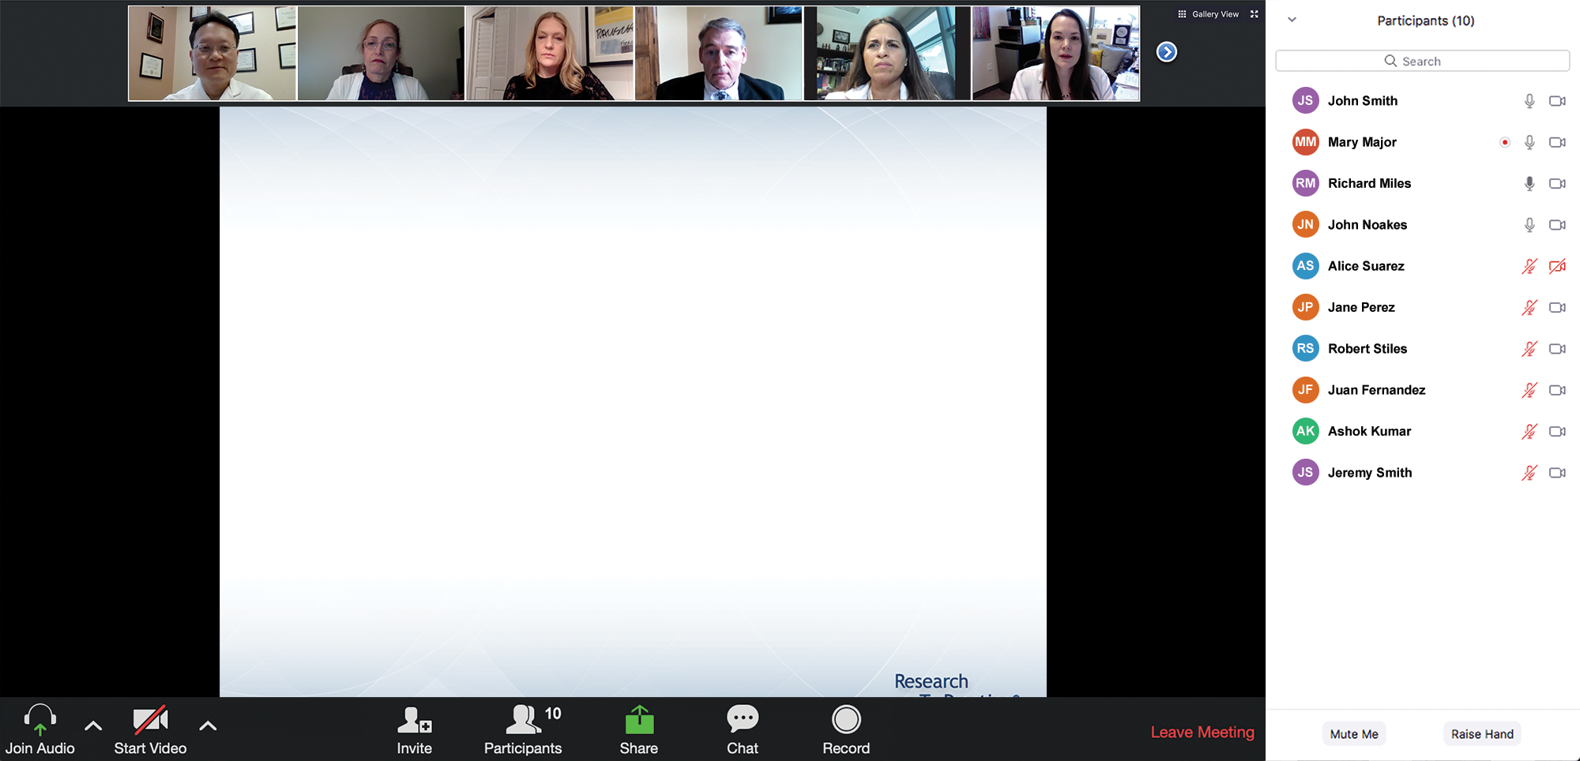
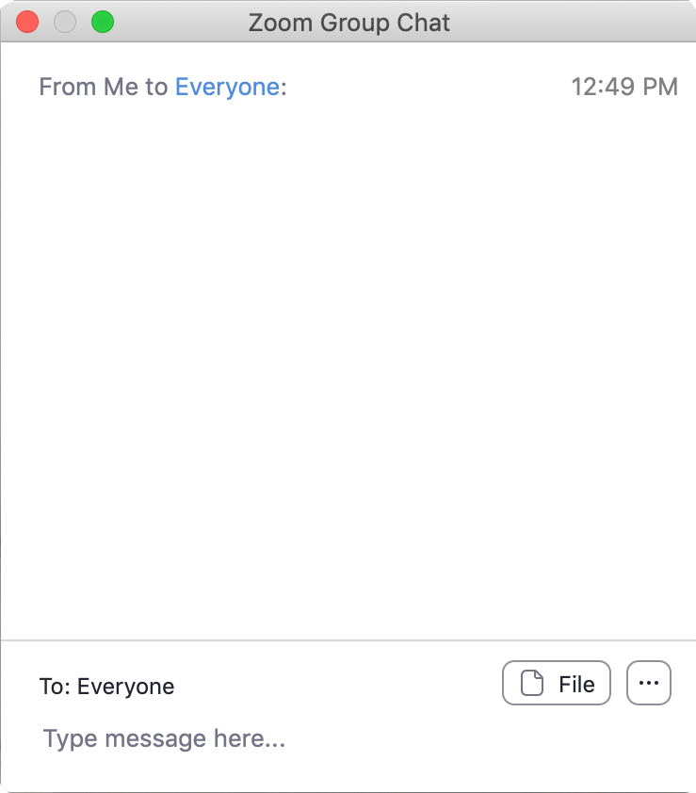
We Encourage Clinicians in Practice to Submit Questions
Feel free to submit questions now before the program begins and throughout the program.

Slide 10
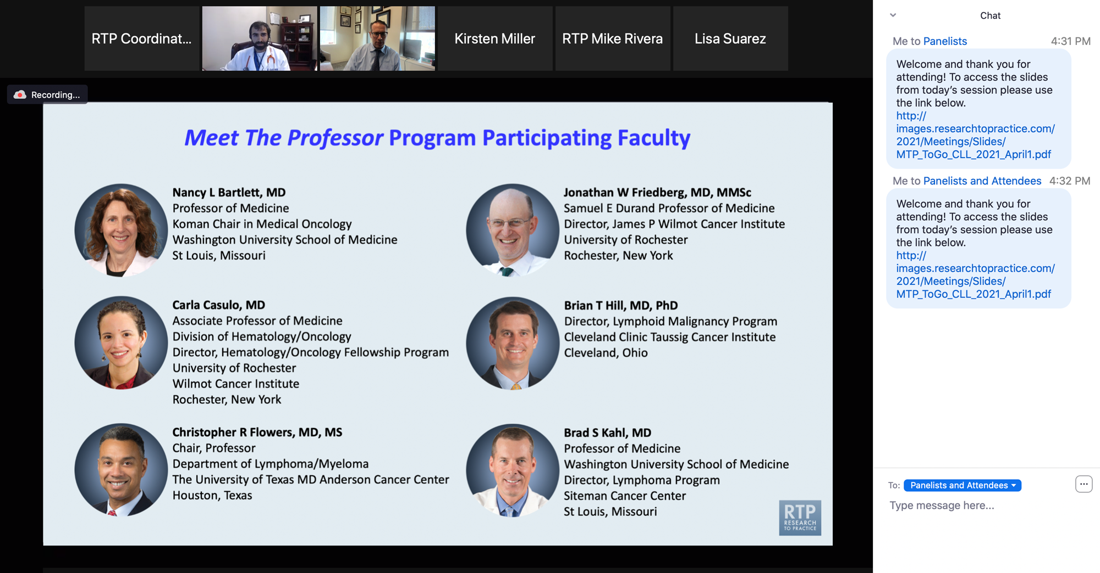
Familiarizing Yourself with the Zoom Interface
Expand chat submission box
Drag the white line above the submission box up to create more space for your message.

Slide 11
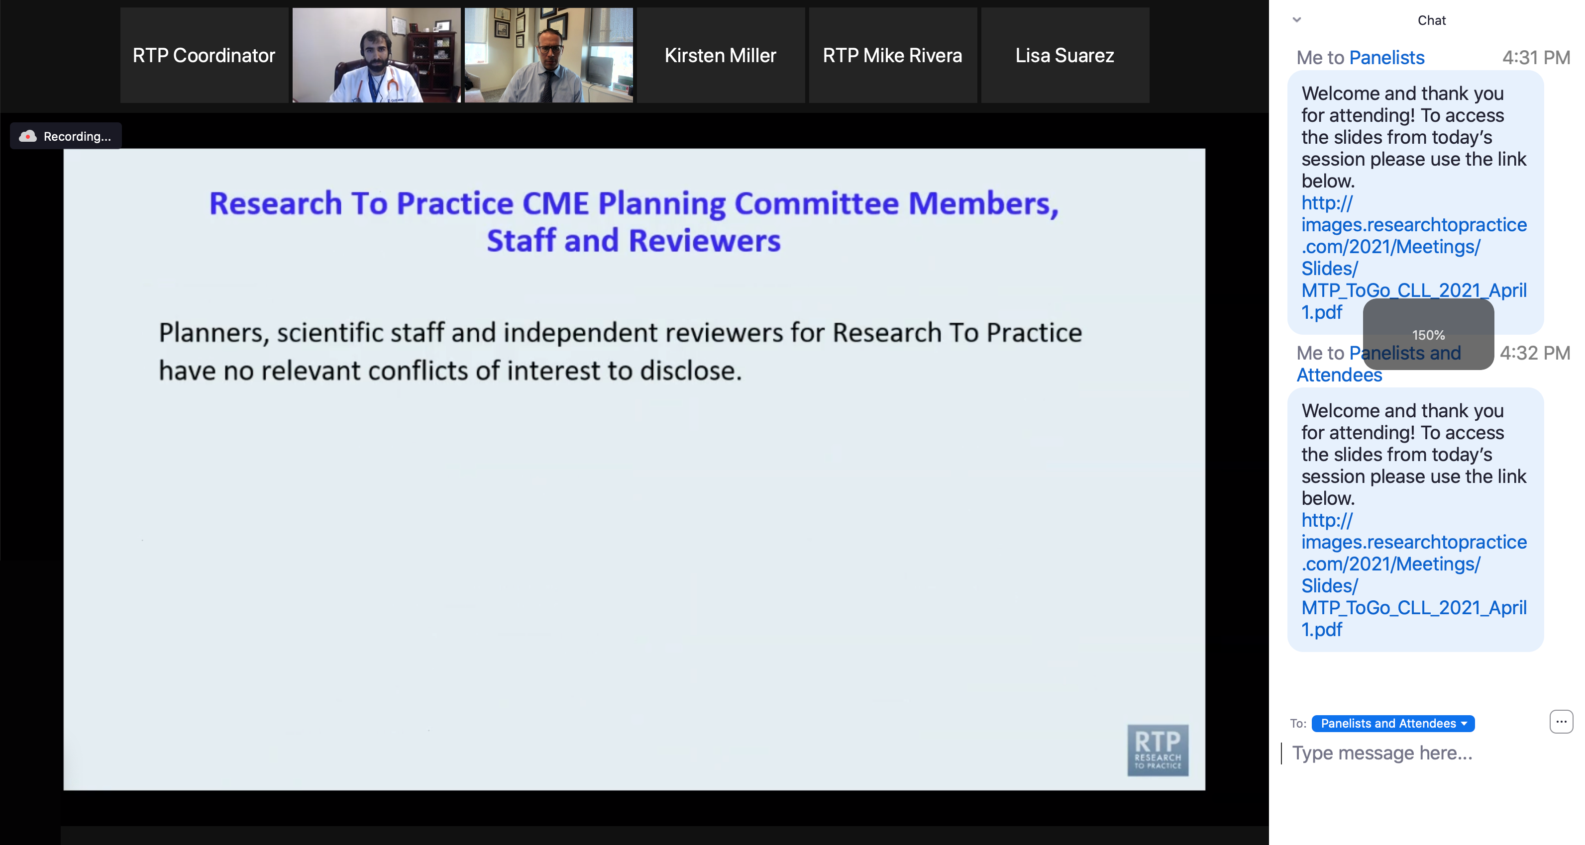
Familiarizing Yourself with the Zoom Interface
Increase chat font size
Press Command (for Mac) or Control (for PC) and the + symbol. You may do this as many times as you need for readability.

Slide 12
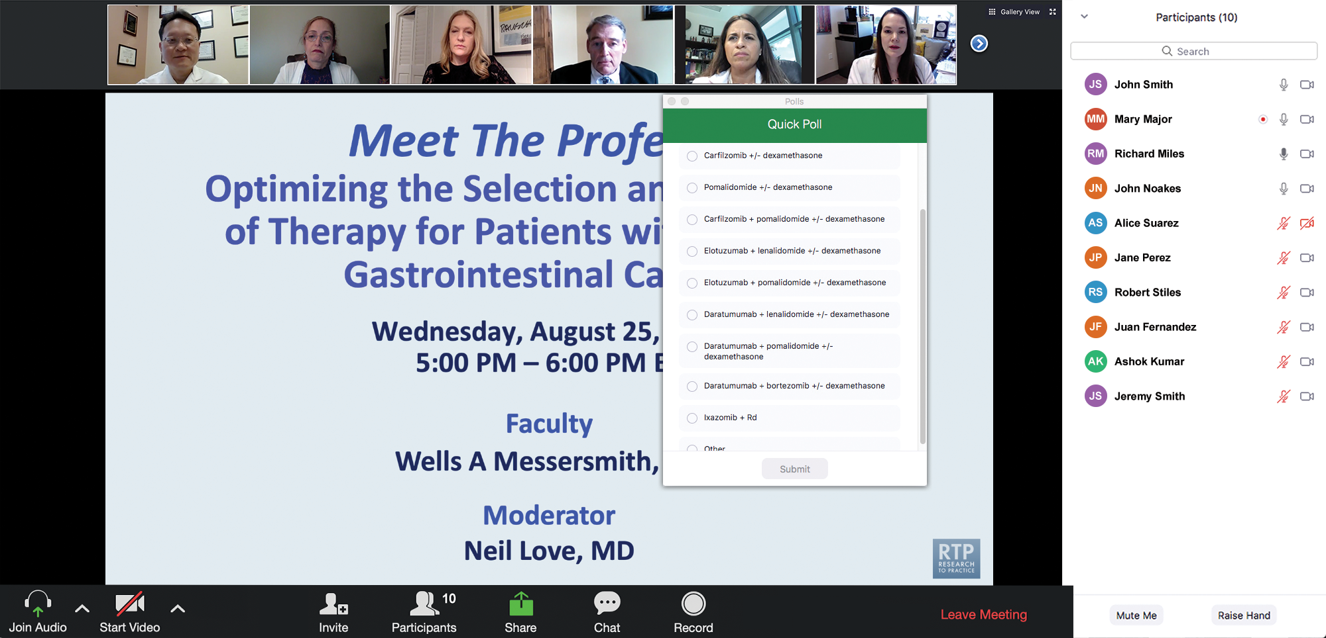
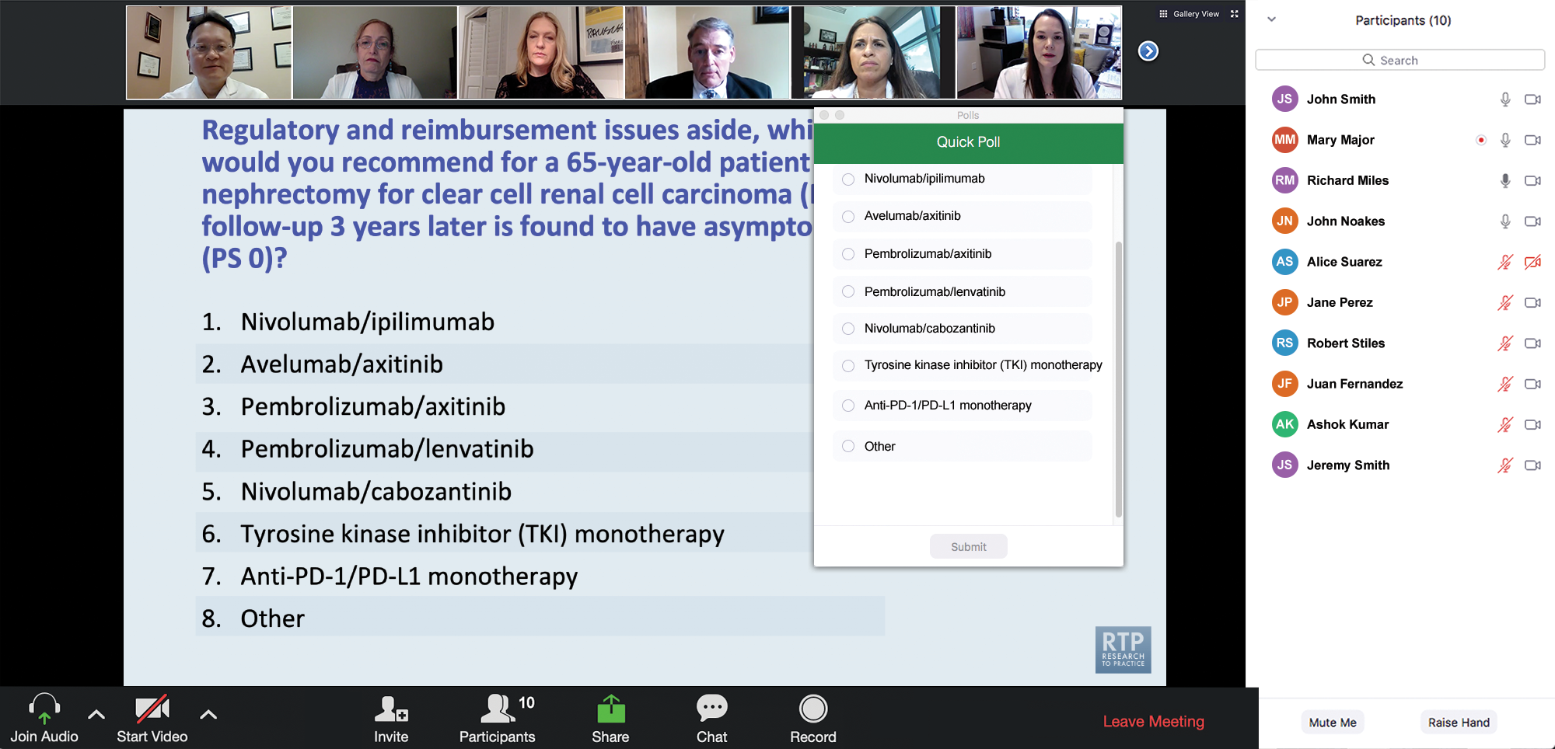
Clinicians in the Audience, Please Complete the Pre- and Postmeeting Surveys
Quick Survey
Quick Poll

Slide 13
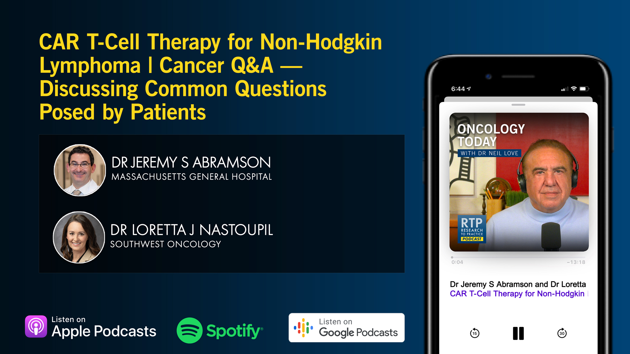

Slide 14
Expert Second Opinion: Investigators Discuss the Optimal Management of Gastrointestinal Cancers
A CME Symposium Series Held Adjunct to the 2026 ASCO® Gastrointestinal Cancers Symposium
HER2-Positive Gastrointestinal Cancers
Thursday, January 8, 2026
7:15 PM – 8:45 PM PT (10:15 PM – 11:45 PM ET)
Localized Colorectal Cancer
Thursday, January 8, 2026
7:15 PM – 8:45 PM PT (10:15 PM – 11:45 PM ET)
Advanced Gastroesophageal Cancers
Friday, January 9, 2026
6:00 PM – 8:00 PM PT (9:00 PM – 11:00 PM ET)

Slide 15
Grand Rounds
CME/MOC-Accredited Interactive Series
Through April 2026
Three Series
Optimizing Treatment for Patients with Relapsed/Refractory Chronic Lymphocytic Leukemia
Optimizing the Use of Novel Therapies for Patients with Diffuse Large B-Cell Lymphoma
Optimizing Therapy for Patients with Hormone Receptor-Positive Localized Breast Cancer
Host a 1-hour session at your institution: Email Meetings@ResearchToPractice.com or call (800) 233-6153

Slide 16

Save The Date
A Multitumor CME/MOC-, NCPD- and ACPE-Accredited Educational Conference Developed in Partnership with Florida Cancer Specialists & Research Institute
Friday to Sunday, April 24 to 26, 2026
The Ritz-Carlton Orlando, Grande Lakes | Orlando, Florida
Moderated by Neil Love, MD

Slide 17
Thank you for joining us! Please take a moment to complete the survey currently up on Zoom. Your feedback is very important to us. Information on how to obtain CME and ABIM MOC credit will be provided at the conclusion of the activity in the Zoom chat room. Attendees will also receive an email in 1 to 3 business days with these instructions.

Slide 18
Practical Perspectives on the Current Role of Bispecific Antibodies in the Management of Lymphoma — What Happened at ASH 2025?
A CME/MOC-Accredited Live Webinar
Wednesday, December 17, 2025 5:00 PM – 6:00 PM ET
Faculty
Michael Dickinson, MD
Laurie H Sehn, MD, MPH
Moderator
Neil Love, MD

Slide 19
Faculty
Michael Dickinson, MD
Hematologist
Lead of Aggressive Lymphoma
Peter MacCallum Cancer Centre
and Royal Melbourne Hospital
Melbourne, Australia
MODERATOR
Neil Love, MD Research To Practice Miami, Florida
Laurie H Sehn, MD, MPH
Chair, Lymphoma Tumour Group
BC Cancer Centre for Lymphoid Cancer
Clinical Professor of Medicine
The University of British Columbia
Vancouver, British Columbia, Canada

Slide 20
We Encourage Clinicians in Practice to Submit Questions
Feel free to submit questions now before the program begins and throughout the program.

Slide 21
Clinicians in the Audience, Please Complete the Pre- and Postmeeting Surveys
Quick Survey
Quick Poll

Slide 23
Expert Second Opinion: Investigators Discuss the Optimal Management of Gastrointestinal Cancers
A CME Symposium Series Held Adjunct to the 2026 ASCO® Gastrointestinal Cancers Symposium
HER2-Positive Gastrointestinal Cancers
Thursday, January 8, 2026
7:15 PM – 8:45 PM PT (10:15 PM – 11:45 PM ET)
Localized Colorectal Cancer
Thursday, January 8, 2026
7:15 PM – 8:45 PM PT (10:15 PM – 11:45 PM ET)
Advanced Gastroesophageal Cancers
Friday, January 9, 2026
6:00 PM – 8:00 PM PT (9:00 PM – 11:00 PM ET)

Slide 24
Grand Rounds
CME/MOC-Accredited Interactive Series
Through April 2026
Three Series
Optimizing Treatment for Patients with Relapsed/Refractory Chronic Lymphocytic Leukemia
Optimizing the Use of Novel Therapies for Patients with Diffuse Large B-Cell Lymphoma
Optimizing Therapy for Patients with Hormone Receptor-Positive Localized Breast Cancer
Host a 1-hour session at your institution: Email Meetings@ResearchToPractice.com or call (800) 233-6153

Slide 25
Save The Date
A Multitumor CME/MOC-, NCPD- and ACPE-Accredited Educational Conference Developed in Partnership with Florida Cancer Specialists & Research Institute
Friday to Sunday, April 24 to 26, 2026
The Ritz-Carlton Orlando, Grande Lakes | Orlando, Florida
Moderated by Neil Love, MD

Slide 26
Practical Perspectives on the Current Role of Bispecific Antibodies in the Management of Lymphoma — What Happened at ASH 2025?
A CME/MOC-Accredited Live Webinar
Wednesday, December 17, 2025 5:00 PM – 6:00 PM ET
Faculty
Michael Dickinson, MD
Laurie H Sehn, MD, MPH
Moderator
Neil Love, MD

Slide 27
Prof Dickinson — Disclosures
Advisory Committees | AbbVie Inc, Bristol Myers Squibb, Genmab US Inc, Gilead Sciences Inc, Kite, A Gilead Company, Lilly, MSD, Novartis, Roche Laboratories Inc
Consulting Agreements | AbbVie Inc, Arvinas, Bristol Myers Squibb, Genmab US Inc, Gilead Sciences Inc, Kite, A Gilead Company, Lilly, MSD, Novartis, Roche Laboratories Inc

Slide 28
Dr Sehn — Disclosures
Consulting/Honoraria | AbbVie Inc, AstraZeneca Pharmaceuticals LP, BeOne, Bristol Myers Squibb, CARGO Therapeutics, Chugai Pharmaceutical Co Ltd, Genentech, a member of the Roche Group, Genmab US Inc, Incyte Corporation, Janssen Biotech Inc, Kite, A Gilead Company, Lilly, Merck, Seagen Inc
Contracted Research | Genentech, a member of the Roche Group
Data and Safety Monitoring Boards/Committees | CARGO Therapeutics

Slide 29
Dr Love — Disclosures
Dr Love is president and CEO of Research To Practice. Research To Practice receives funds in the form of educational grants to develop CME activities from the following companies: Aadi Bioscience, AbbVie Inc, ADC Therapeutics, Agendia Inc, Alexion Pharmaceuticals, Amgen Inc, Array BioPharma Inc, a subsidiary of Pfizer Inc, Arvinas, Astellas, AstraZeneca Pharmaceuticals LP, Aveo Pharmaceuticals, Bayer HealthCare Pharmaceuticals, BeOne, Biotheranostics Inc, A Hologic Company, Black Diamond Therapeutics Inc, Blueprint Medicines, Boehringer Ingelheim Pharmaceuticals Inc, Bristol Myers Squibb, Celcuity, Clovis Oncology, Coherus BioSciences, Corcept Therapeutics Inc, CTI BioPharma, a Sobi Company, Daiichi Sankyo Inc, Eisai Inc, Elevation Oncology Inc, Exact Sciences Corporation, Exelixis Inc, Genentech, a member of the Roche Group, Genmab US Inc, Geron Corporation, Gilead Sciences Inc, GSK, Helsinn Therapeutics (US) Inc, ImmunoGen Inc, Incyte Corporation, Ipsen Biopharmaceuticals Inc, Jazz Pharmaceuticals Inc, Johnson & Johnson, Karyopharm Therapeutics, Kite, A Gilead Company, Kura Oncology, Legend Biotech, Lilly, MEI Pharma Inc, Merck, Mersana Therapeutics Inc, Mirati Therapeutics Inc, Mural Oncology Inc, Natera Inc, Novartis, Novartis Pharmaceuticals Corporation on behalf of Advanced Accelerator Applications, Novocure Inc, Nuvalent, Pfizer Inc, Pharmacyclics LLC, an AbbVie Company, Puma Biotechnology Inc, Regeneron Pharmaceuticals Inc, Rigel Pharmaceuticals Inc, R-Pharm US, Sanofi, Seagen Inc, Servier Pharmaceuticals LLC, SpringWorks Therapeutics Inc, Stemline Therapeutics Inc, Sumitomo Pharma America, Syndax Pharmaceuticals, Taiho Oncology Inc, Takeda Pharmaceuticals USA Inc, TerSera Therapeutics LLC, and Tesaro, A GSK Company.

Slide 30
Commercial Support
This activity is supported by an educational grant from Genentech, a member of the Roche Group.
Research To Practice CME Planning Committee Members, Staff and Reviewers
Planners, scientific staff and independent reviewers for Research To Practice have no relevant conflicts of interest to disclose.

Slide 31
This educational activity contains discussion of non-FDA-approved uses of agents and regimens. Please refer to official prescribing information for each product for approved indications.

Slide 32
Key Datasets
Michael Dickinson, MD
Karimi Y et al. Sustained remissions beyond 4 years with epcoritamab monotherapy: Long term follow-up results from the pivotal EPCORE NHL-1 trial in patients with relapsed or refractory large B-cell lymphoma. ASH 2025;Abstract 7543.
Abramson J et al. Sustained clinical benefit of glofitamab plus gemcitabine and oxaliplatin (GemOx) versus rituximab plus GemOx (R-GemOx) in patients with relapsed/refractory (R/R) diffuse large B-cell lymphoma (DLBCL): 3-year follow-up of STARGLO. ASH 2025;Abstract 11363.
Budde E et al. Improvements in health-related quality of life (HRQoL) in the SUNMO study: Subcutaneous (SC) mosunetuzumab plus polatuzumab vedotin (Mosun-Pola) vs rituximab, gemcitabine and oxaliplatin (R-GemOx) in patients with relapsed/refractory (R/R) large B-cell lymphoma (LBCL) after at least one prior therapy. ASH 2025;Abstract 2516.
Gritti G et al. Glofitamab in combination with polatuzumab vedotin demonstrates high and durable efficacy in patients with relapsed/refractory (R/R) large B-cell lymphoma (LBCL) in the second-line (2L) and third-line and later (3L+) settings: A subgroup analysis. ASH 2025;Abstract 4000.
Andreadis C et al. Mosunetuzumab (Mosun) or glofitamab (Glofit) in combination with golcadomide (Golca) demonstrates a manageable safety profile and encouraging efficacy in patients with relapsed or refractory (R/R) B-cell non-Hodgkin lymphoma (B-NHL). ASH 2025;Abstract 2260.

Slide 33
Key Datasets
Michael Dickinson, MD (continued)
Sharman J et al. Fixed treatment duration subcutaneous mosunetuzumab monotherapy in elderly/unfit patients with previously untreated diffuse large B-cell lymphoma: Interim results from the Phase II MorningSun study. ASH 2025;Abstract 4514.
Vitolo U et al. Fixed-duration epcoritamab monotherapy induces high response and MRD-negativity rates in elderly patients with newly diagnosed large B-cell lymphoma (LBCL) and comorbidities: Results from EPCORE DLBCL-3. ASH 2025;Abstract 3824.
Michot J-M et al. Odronextamab plus chemotherapy in patients with previously untreated diffuse large B-cell lymphoma (DLBCL): First results from part 1 of the phase 3 Olympia-3 study. ASH 2025;Abstract 8890.

Slide 34
Key Datasets
Laurie H Sehn, MD, MPH
Budde E et al. Fixed treatment duration mosunetuzumab continues to demonstrate clinically meaningful outcomes in patients with relapsed/refractory (R/R) follicular lymphoma (FL) after ≥2 prior therapies: 5-year follow-up of a pivotal Phase II study. ASH 2025;Abstract 2148.
Bisneto JV et al. Efficacy and safety of long-term odronextamab treatment in patients with relapsed/refractory follicular lymphoma: 3-year follow-up from the Phase 2 ELM-2 study. ASH 2025;Abstract 8692.
Falchi L et al. Primary phase 3 results from the epcore FL-1 trial of epcoritamab with rituximab and lenalidomide (R2) versus R2 for relapsed or refractory follicular lymphoma. ASH 2025;Abstract 244.
Burke JM et al. Fixed-duration subcutaneous (SC) mosunetuzumab, with maintenance therapy, in patients (pts) with previously untreated high-tumor burden follicular lymphoma (HTB FL): Longer follow-up and exploratory circulating tumor (ct)DNA analysis of the Phase II MorningSun study. ASH 2025;Abstract 4494.
Olszewski A et al. Mosunetuzumab with response-driven lenalidomide augmentation achieves high response rates and immune reprogramming in untreated follicular and marginal zone lymphoma: A multicenter phase 2 trial. ASH 2025;Abstract 2025.
Leslie L et al. Epcoritamab with rituximab + lenalidomide (R2) and epcoritamab maintenance deliver deep and durable remissions in previously untreated (1L) follicular lymphoma (FL): 3-year outcomes from epcore NHL-2 arms 6 and 7. ASH 2025;Abstract 2787.

Slide 35
Key Datasets
Laurie H Sehn, MD, MPH (continued)
Falchi L et al. Combined mosunetuzumab and zanubrutinib for the treatment of patients with newly diagnosed high-burden follicular lymphoma: First results of the multicenter phase 2 mithic-FL2 trial. ASH 2025;Abstract 4355.
Wudhikarn K et al. Odronextamab plus chemotherapy in patients with previously untreated follicular lymphoma: First results from part 1 of the phase 3 Olympia-2 study. ASH 2025;Abstract 11091.
Sano D et al. Promising response rates and manageable safety with mosunetuzumab plus lenalidomide (Mosun-Len) in patients with relapsed/refractory (R/R) follicular lymphoma (FL): US extension cohort from the phase III CELESTIMO study. ASH 2025;Abstract 2295.
Phillips T et al. Interim analysis of the phase II study of glofitamab, lenalidomide and venetoclax (GLOVe) in untreated patients w/ high-risk mantle cell lymphoma. Response and safety outcomes after the completion of stage 1 of 2 enrollment. ASH 2025;Abstract 1966.

Slide 36
Expert Second Opinion Investigators Discuss the Role of Novel Treatment Approaches in the Care of Patients with Follicular Lymphoma and Diffuse Large B-Cell Lymphoma
A CME-Accredited Friday Satellite Symposium Preceding the 67th ASH Annual Meeting
Friday, December 5, 2025
7:00 PM – 9:00 PM ET
Faculty
Nancy L Bartlett, MD
John P Leonard, MD
Matthew Matasar, MD
Loretta J Nastoupil, MD
Professor Pier Luigi Zinzani
Moderator
Neil Love, MD

Slide 37
Agenda
Introduction | Dr Yannucci – 60-year-old man | Future Treatment of Non-Hodgkin Lymphoma (NHL)
Case 1 | Dr Morganstein – 62-year-old man | Dr Sehn – 66-year-old man with early relapsing DLBCL
Case 2 |  | Dr Lunning – 68-year-old man with multiple comorbidities and DLBCL
Faculty Presentation: Diffuse Large B-Cell Lymphoma (DLBCL) — Prof Dickinson
Case 3 | Dr Casulo – 54-year-old woman with relapsed FL
Case 4 | Dr Sehn – 78-year-old man with symptomatic relapsed FL
Faculty Presentation: Follicular Lymphoma (FL) and Other NHL Subtypes — Dr Sehn

Slide 38
Agenda
Introduction | Dr Yannucci – 60-year-old man | Future Treatment of Non-Hodgkin Lymphoma (NHL)
Case 1 | Dr Morganstein – 62-year-old man | Dr Sehn – 66-year-old man with early relapsing DLBCL
Case 2 |  | Dr Lunning – 68-year-old man with multiple comorbidities and DLBCL
Faculty Presentation: Diffuse Large B-Cell Lymphoma (DLBCL) — Prof Dickinson
Case 3 | Dr Casulo – 54-year-old woman with relapsed FL
Case 4 | Dr Sehn – 78-year-old man with symptomatic relapsed FL
Faculty Presentation: Follicular Lymphoma (FL) and Other NHL Subtypes — Dr Sehn

Slide 39

LBA-1
MRD-negative outcomes following a novel, in vivo gene therapy generating anti-BCMA CAR-T cells in patients with RRMM: Preliminary results from inMMyCAR, the first-in-human Phase 1 study of KLN-1010
Simon Harrison¹, P. Joy Ho², Sueh-li Lim³, Stephanie Talam², Hannah Pahl¹, Dharmesh Dingar⁴, Scott Currence⁴, Travis Quigley⁴, Andrew Spencer³
¹Peter MacCallum Cancer Centre, Melbourne, Victoria, Australia; ²Royal Prince Alfred Hospital, Sydney, New South Wales, Australia; ³The Alfred Hospital, Melbourne, Victoria, Australia; ⁴Kelonia Therapeutics, Inc., Boston, Massachusetts, United States.
Presented at the 67th ASH Annual Meeting and Exposition; December 6-9, 2025; Orlando, FL, USA.

Slide 40
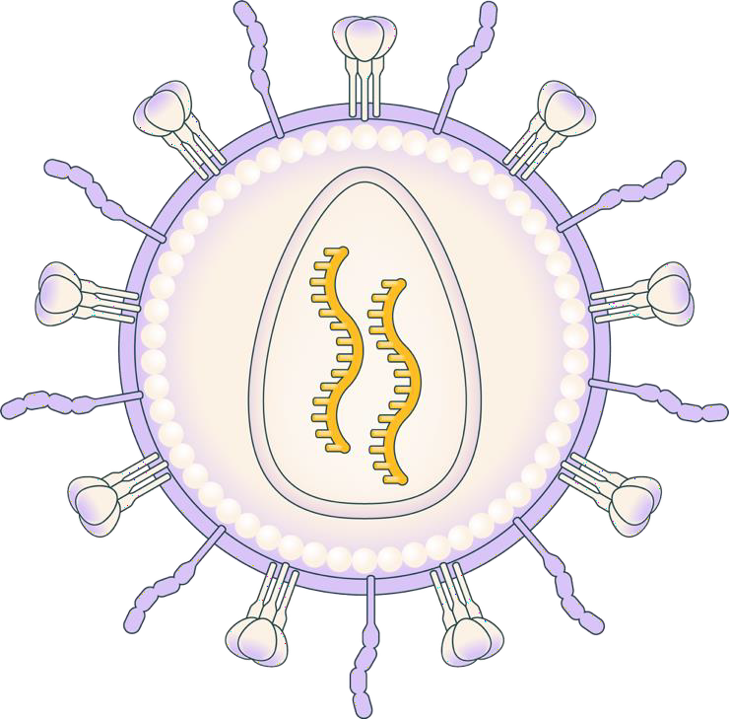


KLN-1010: a modified LVV generating anti-BCMA CAR T cells in vivo
Envelope-modified, replication-incompetent, self-inactivating lentiviral vector
De-targeted VSV-G fusogen avoids delivery to LDL-expressing cells while maintaining high transduction efficiency
Precise re-targeting to T cells with a CD3 scFv; avoids liver uptake and drug sinks
Anti-BCMA CAR was selected based on high levels of activity to BCMA-positive tumors
De-targeted fusogen,
VSV-G mutation
T cell re-targeting with CD3
tropism molecule
CAR molecule
Proprietary, fully-human BCMA scFv
4-1BB
CD3ζ
BCMA, anti–B-cell maturation antigen; CAR, chimeric antigen receptor; CD3, cluster of differentiation 3; CD3ζ, cluster of differentiation 3 zeta chain; LDL, low-density lipoprotein; LVV, lentiviral vector;scFv, single-chain variable fragment;
VSV-G, vesicular stomatitis virus glycoprotein.
Wood JT et al. Toward treatment with gene-modified B cells engineered in vivo using iGPS particles (abstract #1281). Poster presented at: ASGCT 28th Annual Meeting; May 13-17, 2025.

Slide 41
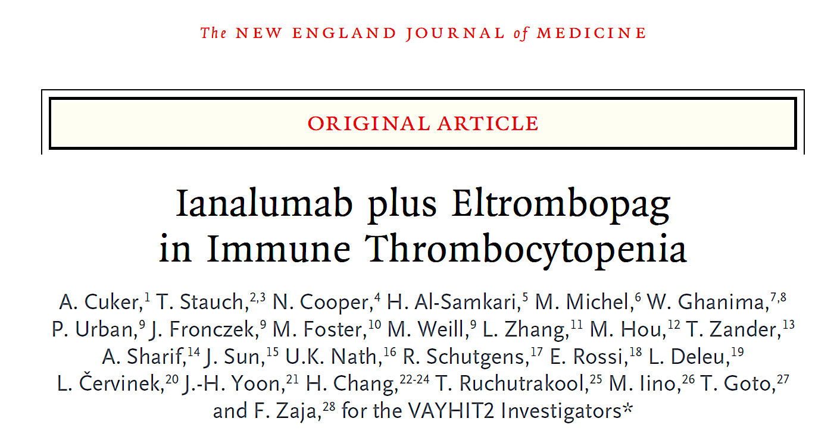
December 9, 2025 [Online ahead of print].

Slide 42
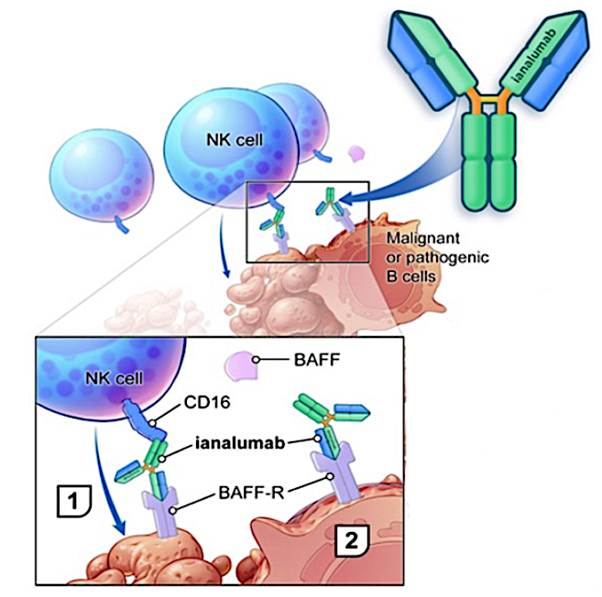
Ianalumab (VAY736) in ITP
Dual mechanism of action:
1) BAFF-R blockade
Prevents activation and differentiation of B-cells and induction of long-lived plasma cells
May overcome rebound/resistance mechanisms (including loss of CD20, BAFF-driven B-cell hyperactivation)
2) Enhanced ADCC-mediated B-cell depletion
Provides more potent, sustained B-cell depletion in blood and tissues
Courtesy of Hanni Al-Samkari, MD

Slide 43
Agenda
Introduction | Dr Yannucci – 60-year-old man | Future Treatment of Non-Hodgkin Lymphoma (NHL)
Case 1 | Dr Morganstein – 62-year-old man | Dr Sehn – 66-year-old man with early relapsing DLBCL
Case 2 |  | Dr Lunning – 68-year-old man with multiple comorbidities and DLBCL
Faculty Presentation: Diffuse Large B-Cell Lymphoma (DLBCL) — Prof Dickinson
Case 3 | Dr Casulo – 54-year-old woman with relapsed FL
Case 4 | Dr Sehn – 78-year-old man with symptomatic relapsed FL
Faculty Presentation: Follicular Lymphoma (FL) and Other NHL Subtypes — Dr Sehn

Slide 44
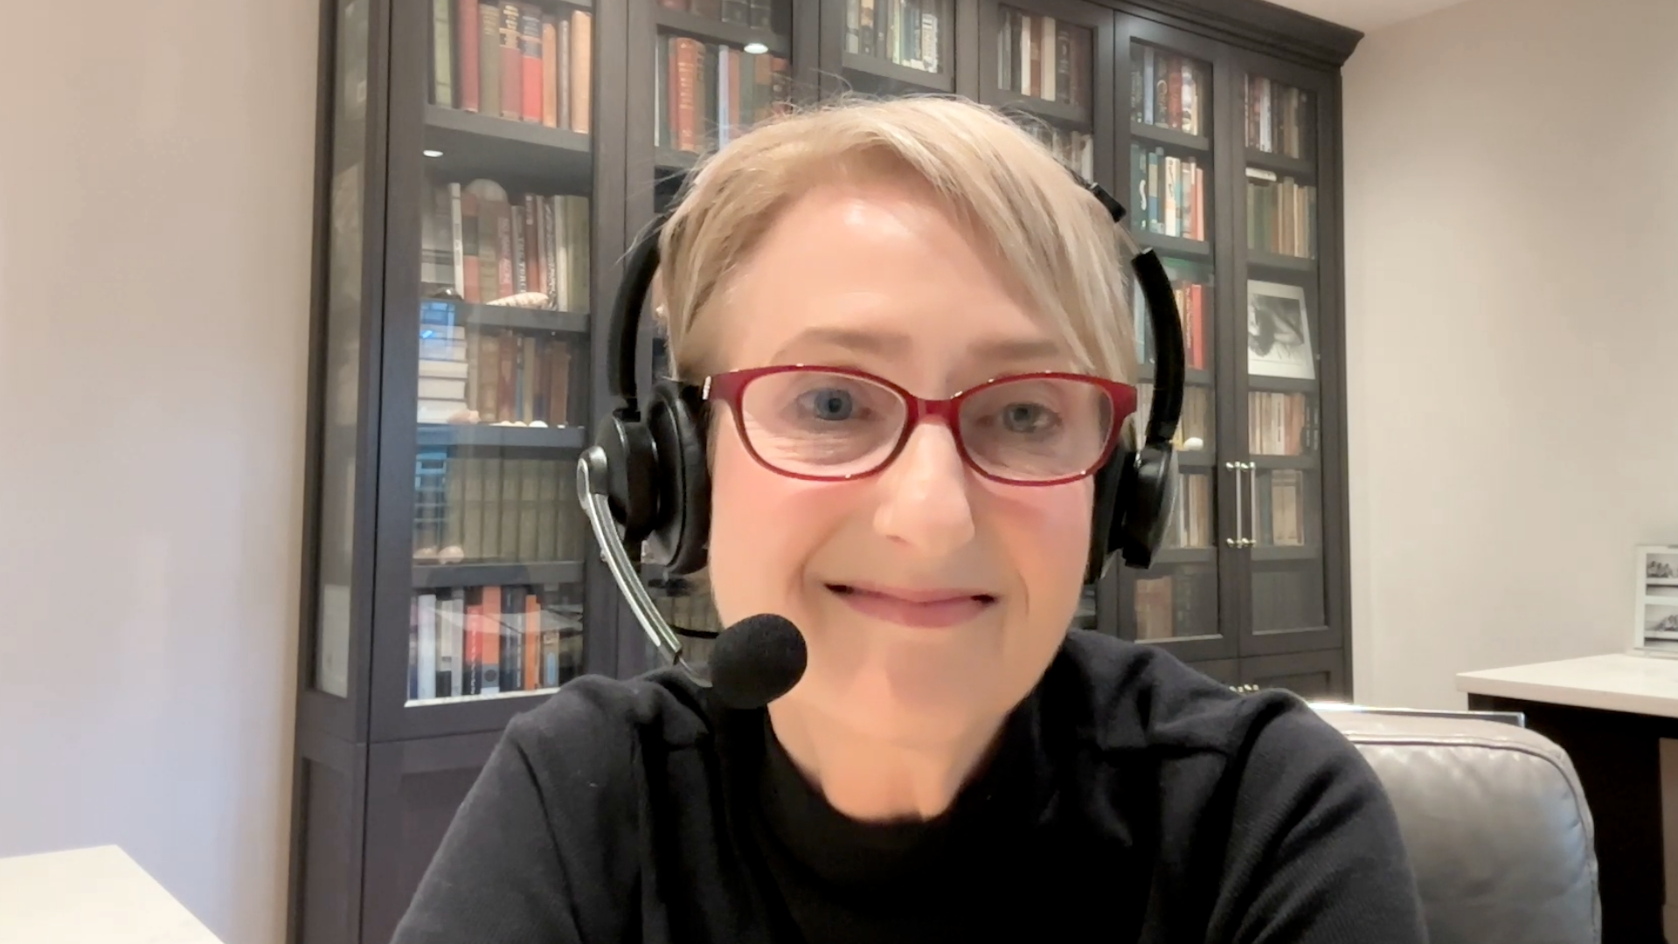
Case Presentation: 66-year-old man with DLBCL and early relapse on axicabtagene ciloleucel receives glofitamab
Dr Laurie Sehn (Vancouver, British Columbia)

Slide 45
Agenda
Introduction | Dr Yannucci – 60-year-old man | Future Treatment of Non-Hodgkin Lymphoma (NHL)
Case 1 | Dr Morganstein – 62-year-old man | Dr Sehn – 66-year-old man with early relapsing DLBCL
Case 2 |  | Dr Lunning – 68-year-old man with multiple comorbidities and DLBCL
Faculty Presentation: Diffuse Large B-Cell Lymphoma (DLBCL) — Prof Dickinson
Case 3 | Dr Casulo – 54-year-old woman with relapsed FL
Case 4 | Dr Sehn – 78-year-old man with symptomatic relapsed FL
Faculty Presentation: Follicular Lymphoma (FL) and Other NHL Subtypes — Dr Sehn

Slide 46
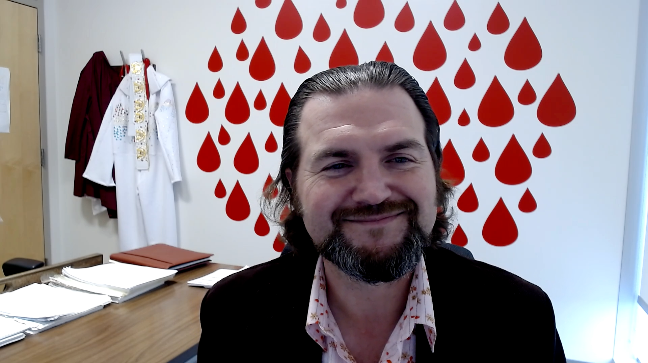
Case Presentation: 68-year-old man with Type 2 diabetes, CHF and COPD receives glofitamab monotherapy after glofitamab + GEMOX for relapsed GCB-type double-hit DLBCL
Dr Matthew Lunning (Omaha, Nebraska)

Slide 47
Agenda
Introduction | Dr Yannucci – 60-year-old man | Future Treatment of Non-Hodgkin Lymphoma (NHL)
Case 1 | Dr Morganstein – 62-year-old man | Dr Sehn – 66-year-old man with early relapsing DLBCL
Case 2 |  | Dr Lunning – 68-year-old man with multiple comorbidities and DLBCL
Faculty Presentation: Diffuse Large B-Cell Lymphoma (DLBCL) — Prof Dickinson
Case 3 | Dr Casulo – 54-year-old woman with relapsed FL
Case 4 | Dr Sehn – 78-year-old man with symptomatic relapsed FL
Faculty Presentation: Follicular Lymphoma (FL) and Other NHL Subtypes — Dr Sehn

Slide 48
Practical Perspectives on the Current Role of Bispecific Antibodies in the Management of Lymphoma — ASH 2025 Review Part 3
Michael Dickinson, MD

Slide 49
CME Agenda
Biological Rationale for and Available Data with CD20 x CD3 Bispecific Antibodies in Lymphoma
Practical Considerations and Future Directions with CD20 x CD3 Bispecific Antibodies in Lymphoma

Slide 50
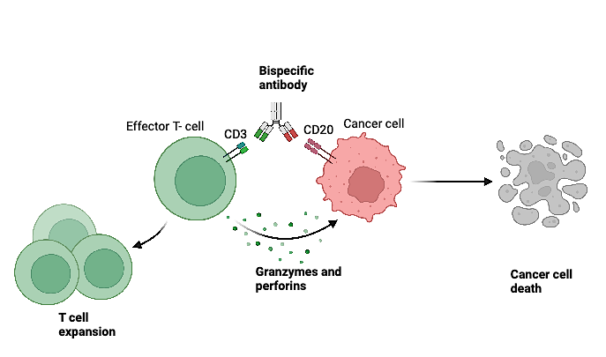
CD3-activating bispecific antibodies – usual target is CD20 on the lymphoma cell, others in development (eg, >1 cancer antigen or CD19)
Approvals in USA:
Epcoritamab and glofitamab approved as third or subsequent treatment for diffuse large B-cell lymphoma in the USA.
Mosunetuzumab and epcoritamab as third treatment for follicular lymphoma.
Key specific adverse events: cytokine release syndrome (common) and neurologic toxicity (uncommon).
Frequency and severity vary by product and indication.

Slide 51
Key Themes from ASH 25 in Bispecific Antibodies (BsAbs) for Diffuse Large B-Cell Lymphoma
Updates on key registration data (BsAb monotherapy and combos)
New combination treatments
New indications in lymphoma

Slide 52
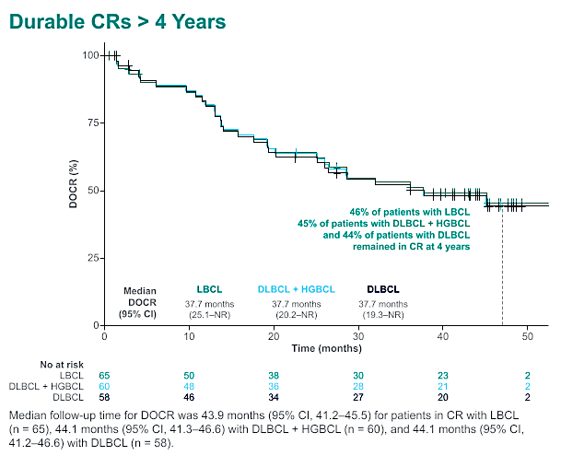
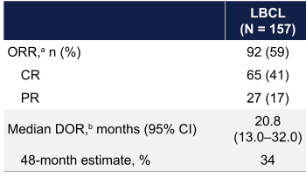
Karimi Y et al. Sustained remissions beyond 4 years with epcoritamab monotherapy: Long term follow-up results from the pivotal EPCORE NHL-1 trial in patients with relapsed or refractory large B-cell lymphoma. ASH 2025;Abstract 7543.
No difference in benefit between
second-line and third-line therapy;
~50% refractory to last line of therapy of second line, 60% in third line
CR = complete response; LBCL = large B-cell lymphoma; DLBCL = diffuse LBCL; HGBCL = high-grade B-cell lymphoma; DOCR = duration of CR; ORR = overall response rate; PR = partial response; DOR = duration of response

Slide 53
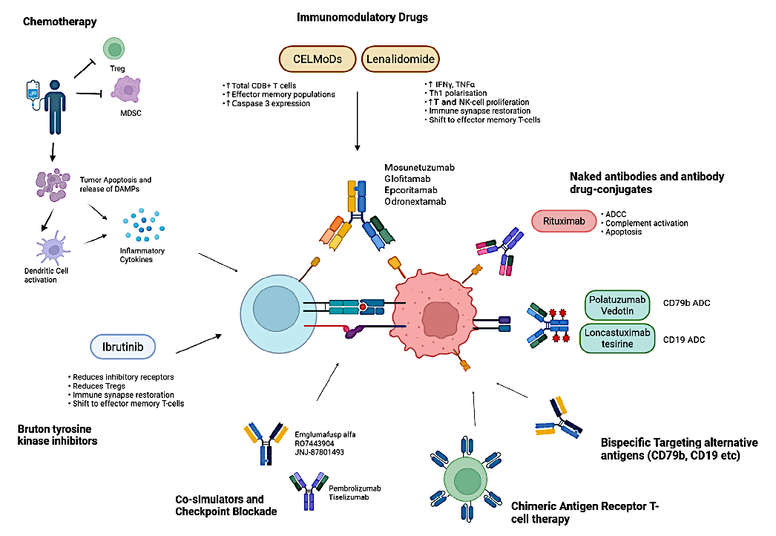
Combinations
Harrop S et al. Br J Haematol 2025;[Online ahead of print].

Slide 54
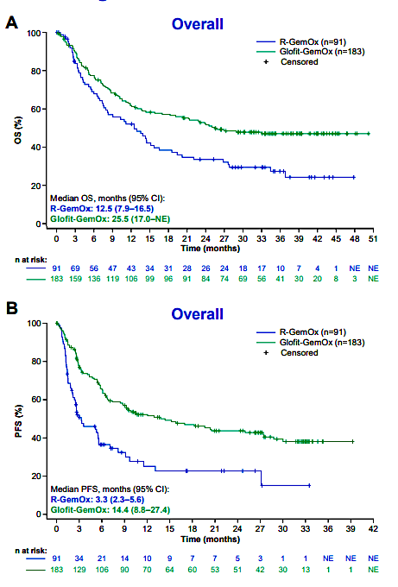
Abramson J et al. Sustained clinical benefit of glofitamab plus gemcitabine and oxaliplatin (GemOx) versus rituximab plus GemOx (R-GemOx) in patients with relapsed/refractory (R/R) diffuse large B-cell lymphoma (DLBCL): 3-year follow-up of STARGLO. ASH 2025;Abstract 11363.
0.60
Median OS follow-up was 35.1 months
– median OS: 25.5 vs 12.5 months (hazard ratio [HR] 0.60; 95% CI: 0.43–0.8)
– median PFS: 14.4 vs 3.3 months (HR 0.41; 95% CI: 0.29–0.57).
Restricting analysis
NOS = not otherwise specified; OS = overall survival; PFS = progression-free survival; AEs = adverse events

Slide 55
SUNMO Trial (Mosun-Pola versus R GemOx)
PFS was longer with Mosun-Pola than with R-GemOx (11.5 months [95% CI, 5.6 to 18] versus 3.8 months [95% CI, 2.9 to 4.1]; hazard ratio for progression or death 0.41 [95% CI, 0.3 to 0.6]; p<0.0001).
Complete response rates of 51% and 24%.
Mosun-Pola = mosunetuzumab with polatuzumab vedotin
Budde et al. J Clin Oncol October 2025; Budde el al. ASH 2025;Poster 5509 (QOL)

Slide 56
Gritti G et al. Glofitamab in combination with polatuzumab vedotin demonstrates high and durable efficacy in patients with relapsed/refractory (R/R) large B-cell lymphoma (LBCL) in the second-line (2L) and third-line and later (3L+) settings: A subgroup analysis. ASH 2025;Abstract 4000.

Slide 57
Andreadis C et al. Mosunetuzumab (Mosun) or glofitamab (Glofit) in combination with golcadomide (Golca) demonstrates a manageable safety profile and encouraging efficacy in patients with relapsed or refractory (R/R) B-cell non-Hodgkin lymphoma (B-NHL). ASH 2025;Abstract 2260.

Slide 58
Mosun or Glofit with Golcadomide: Patient Profile

Slide 59
Mosun or Glofit with Golcadomide: Efficacy (Small Numbers)

Slide 60
Moving BsAb to First Therapy for DLBCL
Randomised trials comparing R-CHOP or R-Pola-CHP to a regimen that adds a BsAb are ongoing.
Second-line trials show addition of BsAb to pola or chemotherapy improves outcomes.
Are BsAb effective enough to allow de-escalation of chemotherapy?

Slide 61
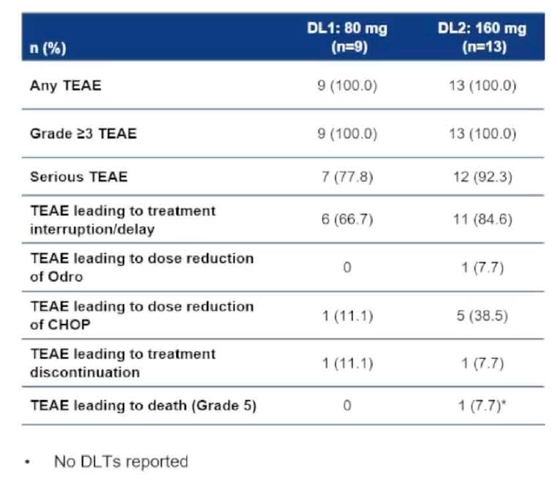
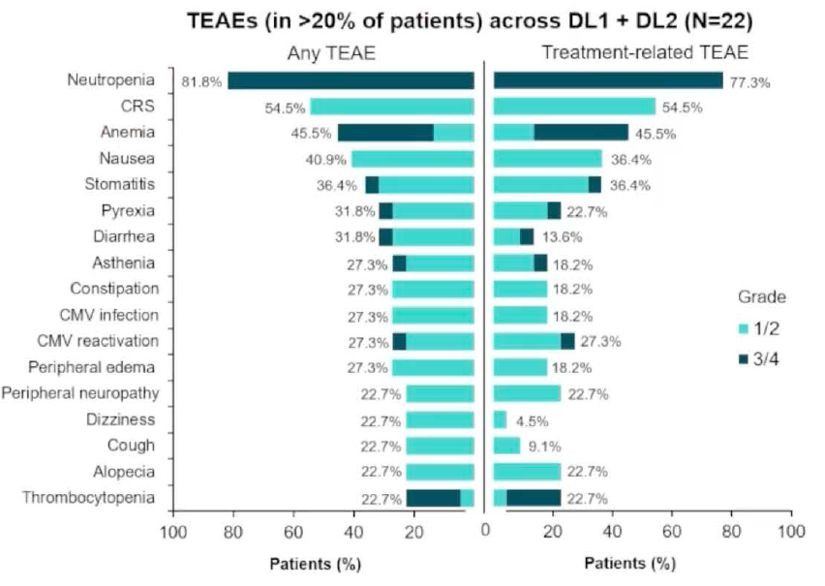
Michot J-M et al. Odronextamab plus chemotherapy in patients with previously untreated DLBCL: First results from part 1 of the phase 3 OLYMPIA-3 study. ASH 2025;Abstract 8890.

Slide 62
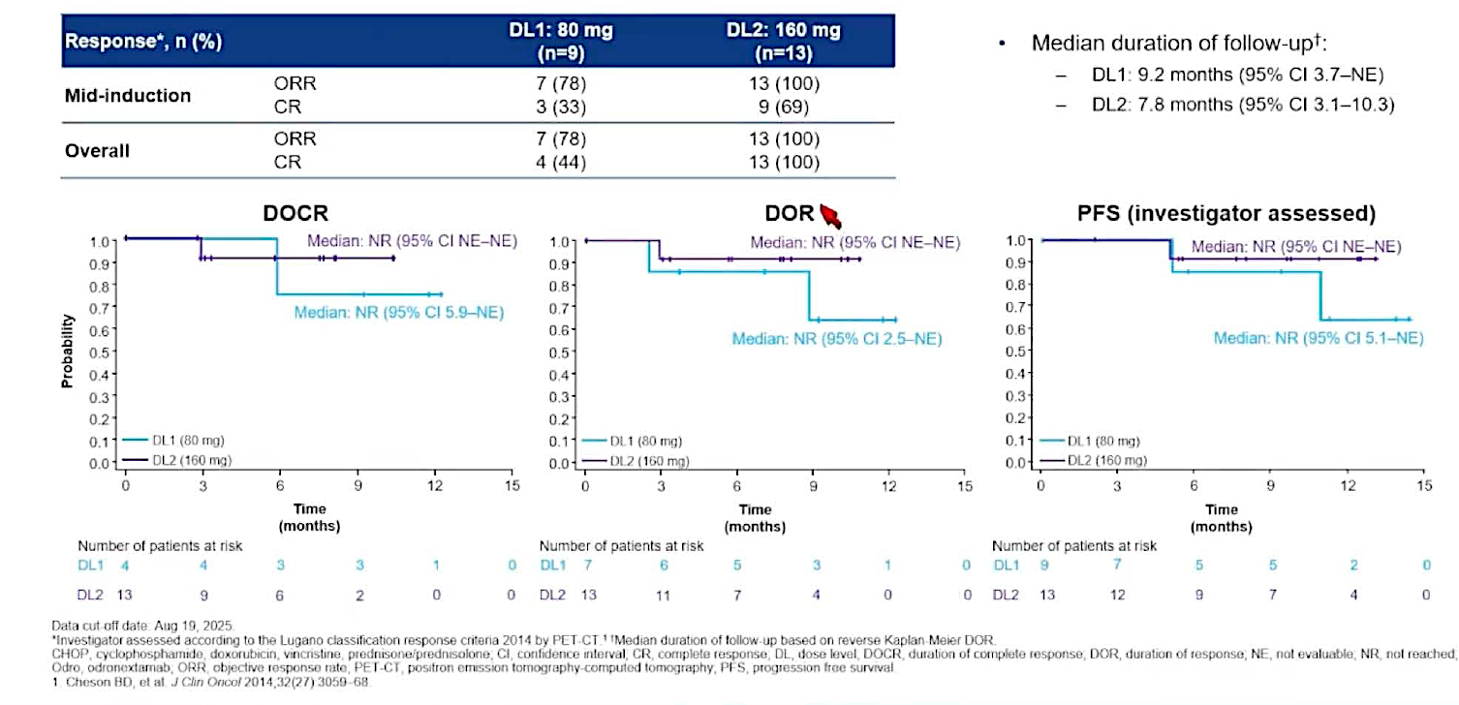
Michot J-M et al. Odronextamab plus chemotherapy in patients with previously untreated DLBCL: First results from part 1 of the phase 3 OLYMPIA-3 study. ASH 2025;Abstract 8890.

Slide 63
Sharman J et al. Fixed treatment duration subcutaneous mosunetuzumab monotherapy in elderly/unfit patients with previously untreated diffuse large B-cell lymphoma: Interim results from the phase II MorningSun study. ASH 2025;Abstract 4514.

Slide 64
Sharman J et al. Fixed treatment duration subcutaneous mosunetuzumab monotherapy in elderly/unfit patients with previously untreated diffuse large B-cell lymphoma: Interim results from the phase II MorningSun study. ASH 2025;Abstract 4514.

Slide 65
Vitolo U et al. Fixed-duration epcoritamab monotherapy induces high response and MRD-negativity rates in elderly patients with newly diagnosed large B-cell lymphoma (LBCL) and comorbidities: Results from EPCORE DLBCL-3. ASH 2025;Abstract 3824.
MRD = minimal residual disease

Slide 66
Vitolo U et al. Fixed-duration epcoritamab monotherapy induces high response and MRD-negativity rates in elderly patients with newly diagnosed large B-cell lymphoma (LBCL) and comorbidities: Results from EPCORE DLBCL-3. ASH 2025;Abstract 3824.

Slide 67
Vitolo U et al. Fixed-duration epcoritamab monotherapy induces high response and MRD-negativity rates in elderly patients with newly diagnosed large B-cell lymphoma (LBCL) and comorbidities: Results from EPCORE DLBCL-3. ASH 2025;Abstract 3824.

Slide 68
Vitolo U et al. Fixed-duration epcoritamab monotherapy induces high response and MRD-negativity rates in elderly patients with newly diagnosed large B-cell lymphoma (LBCL) and comorbidities: Results from EPCORE DLBCL-3. ASH 2025;Abstract 3824.
TEAEs = treatment-emergent adverse events

Slide 69
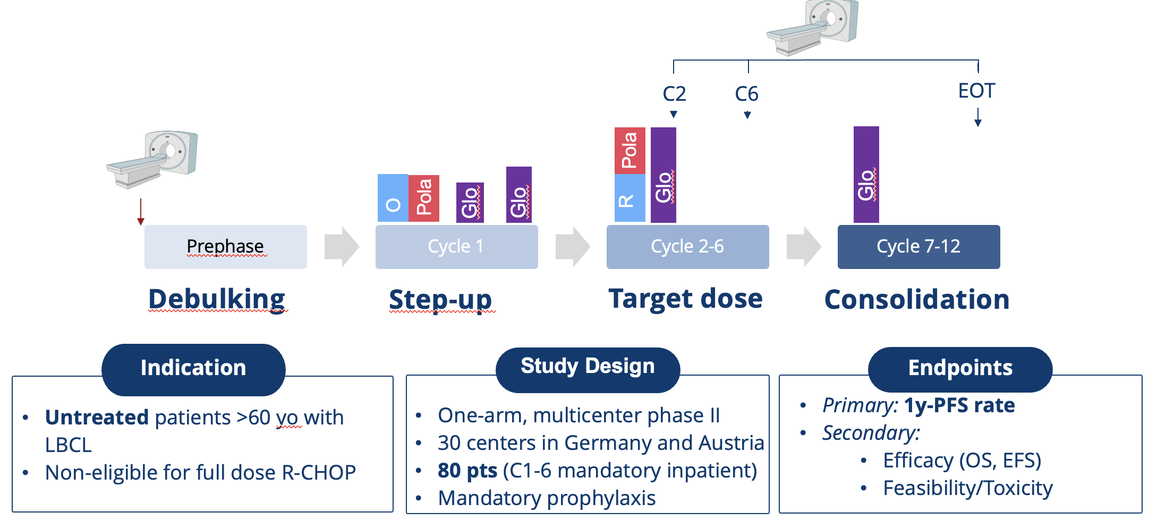
Chapuy B et al. Phase II frontline chemolight R-pola-glo trial induces high and durable response rates in elderly and medically unfit/frail patients with aggressive B-cell lymphoma. ASH 2025;Abstract 61.

Slide 70
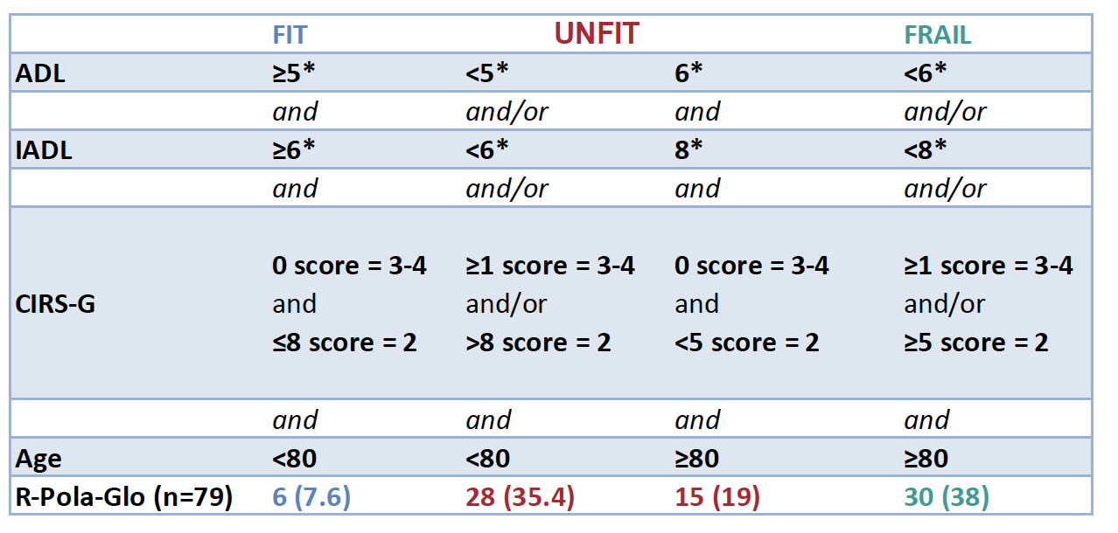
R-Pola-Glo: Patient Characteristics
Baseline Parameters
Simplified Geriatric Assessment (sGA)
Cohort (N=80)
Median age age > 85yo | 80 (66-92) 19%
Advanced Stage (III/IV) | 63% (50/80)
ECOG 2 | 28% (22/80)
LDH, > ULN | 63% (50/80)
IPI 3-5 | 64% (51/80)
91.3% medically unfit/frail
Representative “real-world” cohort of medically unfit/frail patients with high treatment complexity.

Slide 71
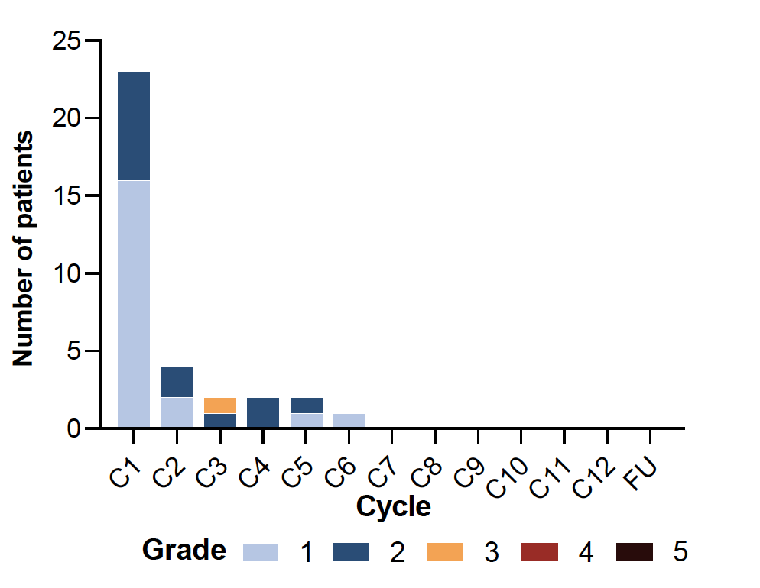
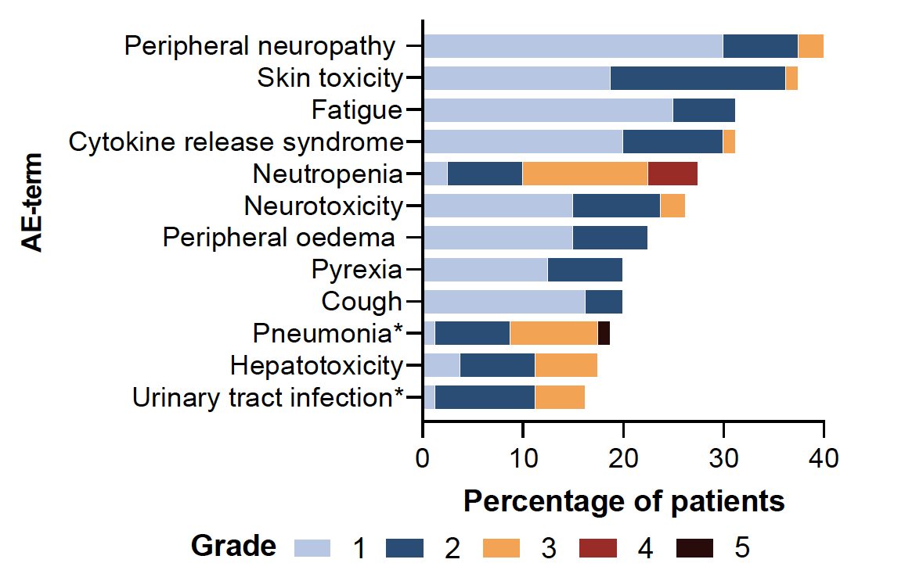
Chapuy B et al. Phase II frontline chemolight R-pola-glo trial induces high and durable response rates in elderly and medically unfit/frail patients with aggressive B-cell lymphoma. ASH 2025;Abstract 61.
All grades | 31% (n=25)
Grade 3 | 1% (n=1)
Grade 4/5 | 0%

Slide 72
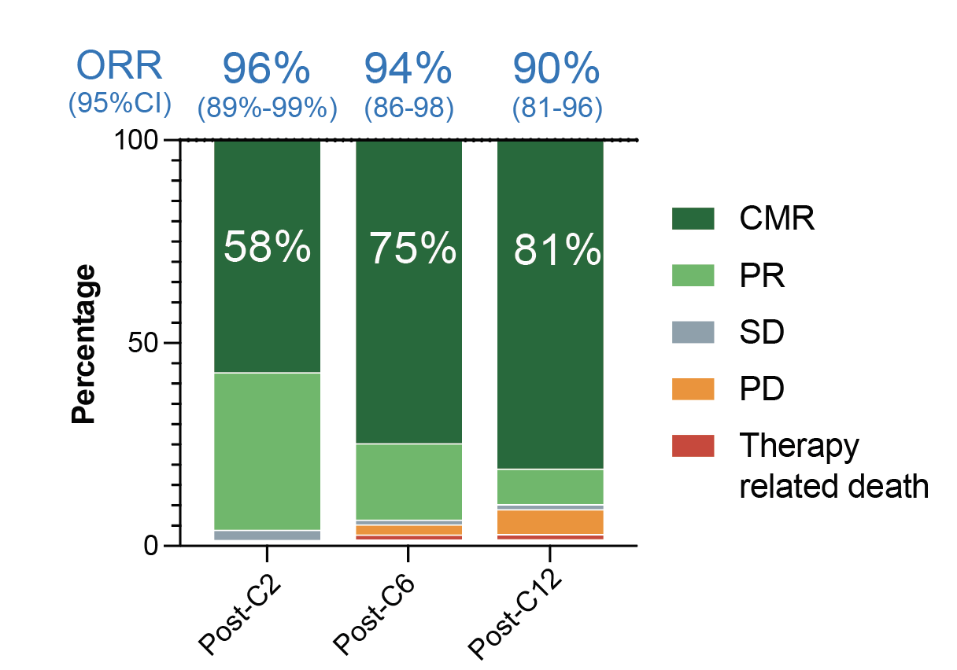
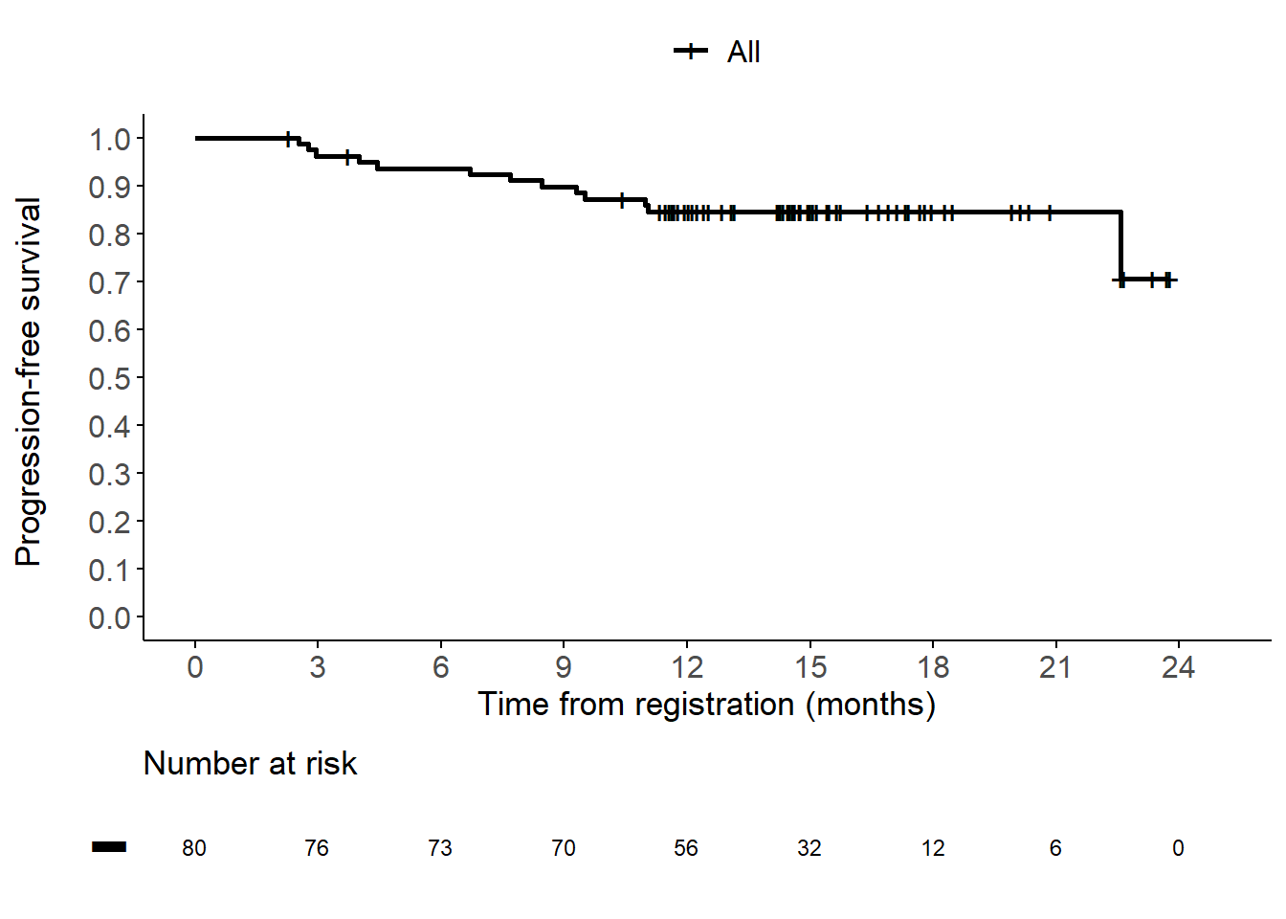
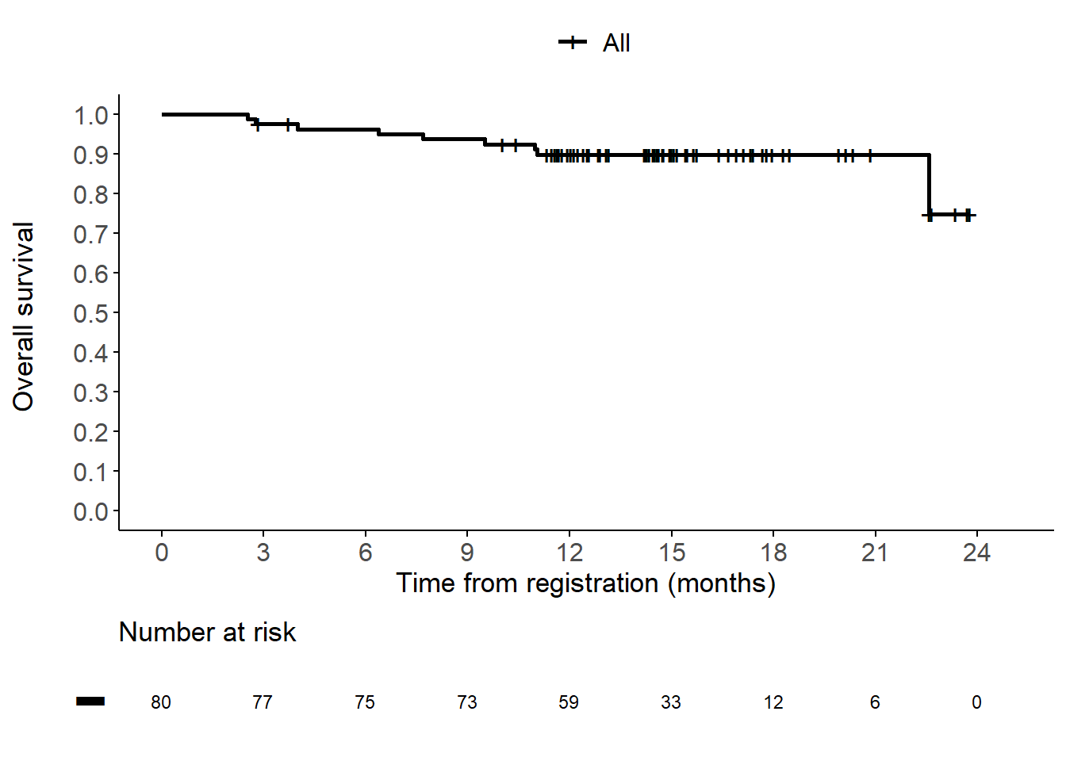
Chapuy B et al. Phase II frontline chemolight R-pola-glo trial induces high and durable response rates in elderly and medically unfit/frail patients with aggressive B-cell lymphoma. ASH 2025;Abstract 61.
1y PFS: 84.6% (95% CI 77.0 – 93.0%)
1y OS: 89.7% (95% CI 83.2 – 96.7%)

Slide 73
Conclusions
Long-term monotherapy results: Durable remissions
Longer follow-up of STARGLO: Sustained benefit
SUNMO: Improved QOL in responders, and in those receiving mosun-pola
Pola-Glo: Striking efficacy in high-risk population including HGBL/DHL
Epco and mosun: Active as single agents in the first line for frail patients
R-Pola-Glo: Possibly more active
CRS: Mosun < R-Pola-Glo < Epco

Slide 74
Agenda
Introduction | Dr Yannucci – 60-year-old man | Future Treatment of Non-Hodgkin Lymphoma (NHL)
Case 1 | Dr Morganstein – 62-year-old man | Dr Sehn – 66-year-old man with early relapsing DLBCL
Case 2 |  | Dr Lunning – 68-year-old man with multiple comorbidities and DLBCL
Faculty Presentation: Diffuse Large B-Cell Lymphoma (DLBCL) — Prof Dickinson
Case 3 | Dr Casulo – 54-year-old woman with relapsed FL
Case 4 | Dr Sehn – 78-year-old man with symptomatic relapsed FL
Faculty Presentation: Follicular Lymphoma (FL) and Other NHL Subtypes — Dr Sehn

Slide 75
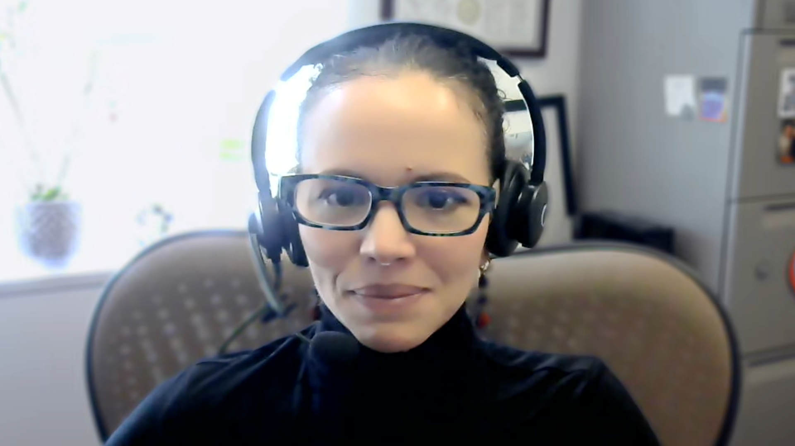
Case Presentation: 54-year-old woman with multiregimen- recurrent FL receives mosunetuzumab
Dr Carla Casulo (Rochester, New York)

Slide 76
Agenda
Introduction | Dr Yannucci – 60-year-old man | Future Treatment of Non-Hodgkin Lymphoma (NHL)
Case 1 | Dr Morganstein – 62-year-old man | Dr Sehn – 66-year-old man with early relapsing DLBCL
Case 2 |  | Dr Lunning – 68-year-old man with multiple comorbidities and DLBCL
Faculty Presentation: Diffuse Large B-Cell Lymphoma (DLBCL) — Prof Dickinson
Case 3 | Dr Casulo – 54-year-old woman with relapsed FL
Case 4 | Dr Sehn – 78-year-old man with symptomatic relapsed FL
Faculty Presentation: Follicular Lymphoma (FL) and Other NHL Subtypes — Dr Sehn

Slide 77
Case Presentation: 78-year-old man with multiregimen- refractory FL receives mosunetuzumab with ongoing CR
Dr Laurie Sehn (Vancouver, British Columbia)

Slide 78
Agenda
Introduction | Dr Yannucci – 60-year-old man | Future Treatment of Non-Hodgkin Lymphoma (NHL)
Case 1 | Dr Morganstein – 62-year-old man | Dr Sehn – 66-year-old man with early relapsing DLBCL
Case 2 |  | Dr Lunning – 68-year-old man with multiple comorbidities and DLBCL
Faculty Presentation: Diffuse Large B-Cell Lymphoma (DLBCL) — Prof Dickinson
Case 3 | Dr Casulo – 54-year-old woman with relapsed FL
Case 4 | Dr Sehn – 78-year-old man with symptomatic relapsed FL
Faculty Presentation: Follicular Lymphoma (FL) and Other NHL Subtypes — Dr Sehn

Slide 79
Follicular Lymphoma and Other NHL Subtypes
Laurie H Sehn, MD, MPH
Chair, Lymphoma Tumour Group
BC Cancer Centre for Lymphoid Cancer
Clinical Professor of Medicine
The University of British Columbia
Vancouver, British Columbia, Canada

Slide 80
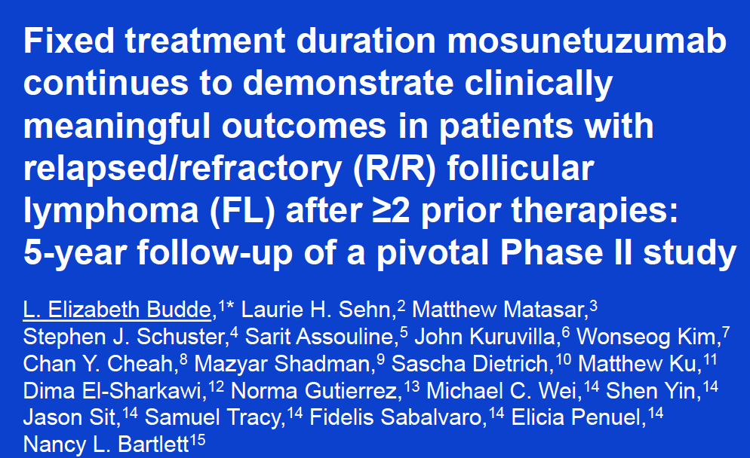
ASH 2025; Abstract 5352

Slide 81
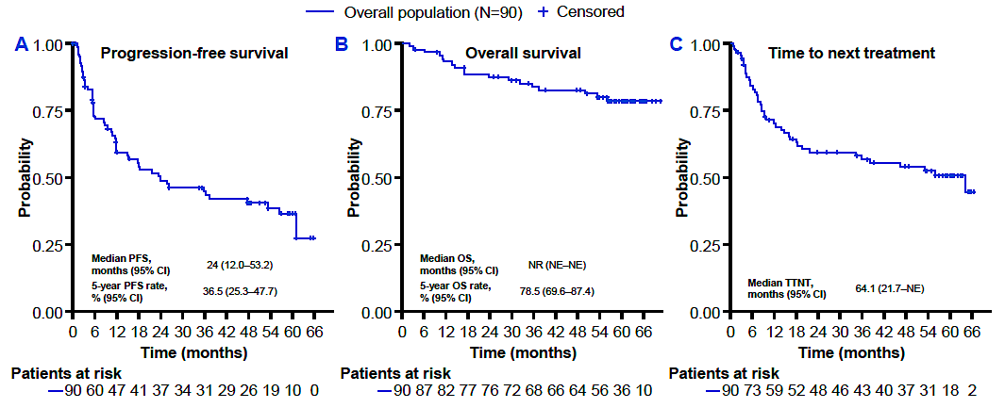
5-Year Update Phase II Pivotal Study: Mosunetuzumab in R/R FL after ≥ 2 Prior Lines
Budde E, et al, ASH 2025

Slide 82
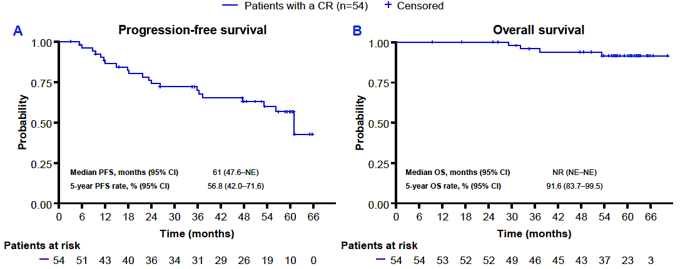
5-Year Update Phase II Pivotal Study: PFS and OS in Patients Achieving a CR
Budde E, et al, ASH 2025

Slide 83
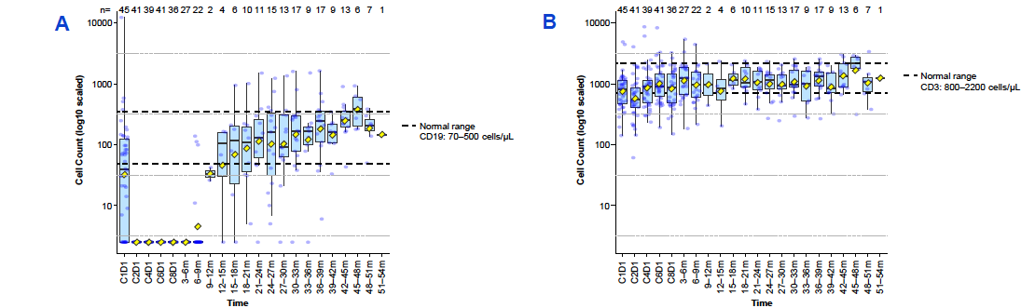
5-Year Update Phase II Pivotal Study: B-Cell and T-Cell Recovery in Patients Achieving a CR
Budde E, et al, ASH 2025

Slide 84
Efficacy and Safety of Long-Term Odronextamab Treatment in Patients with Relapsed/Refractory Follicular Lymphoma: 3-Year Follow-Up from the Phase 2 ELM-2 Study. Bisneto JV et al. ASH 2025;Abstract 3588.

Slide 85
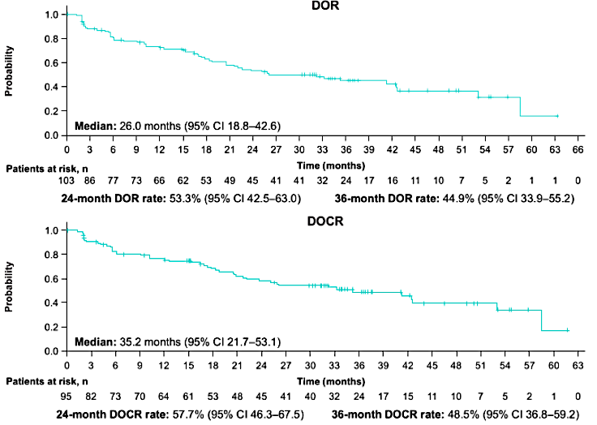
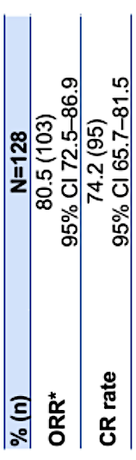
Efficacy and Safety of Long-term Odronextamab in R/R FL: 3-Year Follow-up of ELM-2 Study
Median follow-up duration: 39.2 m
Bisneto, JV, et al, ASH 2025

Slide 86
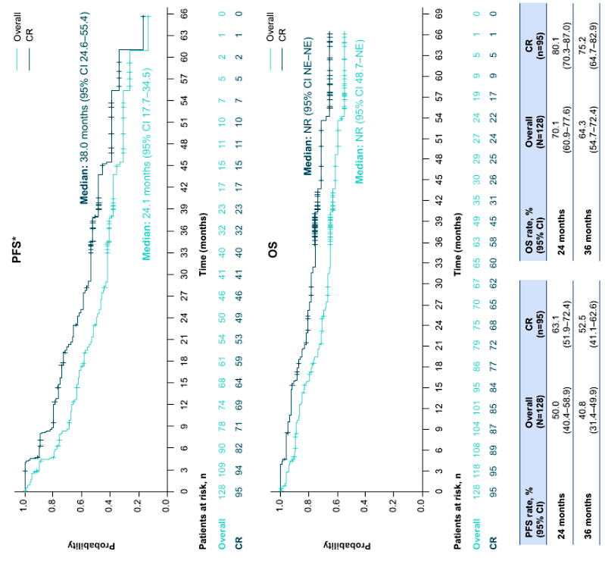
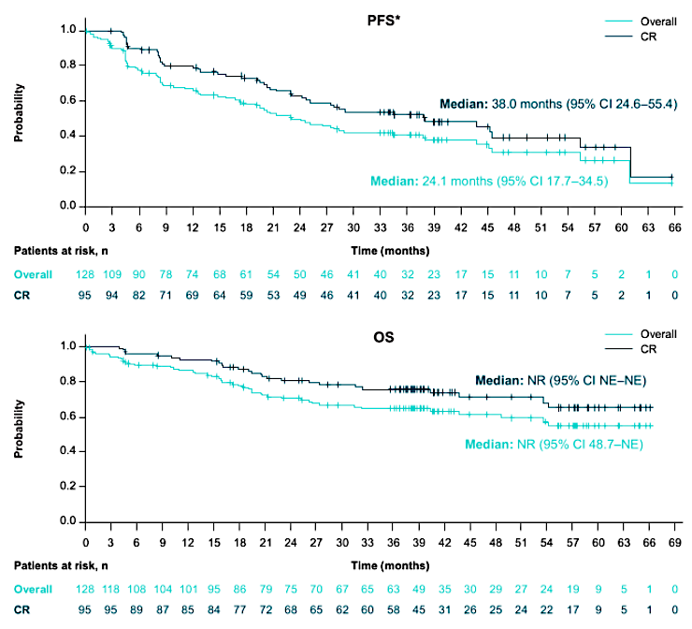
Efficacy and Safety of Long-term Odronextamab in R/R FL: PFS and OS
Bisneto, JV, et al, ASH 2025

Slide 87
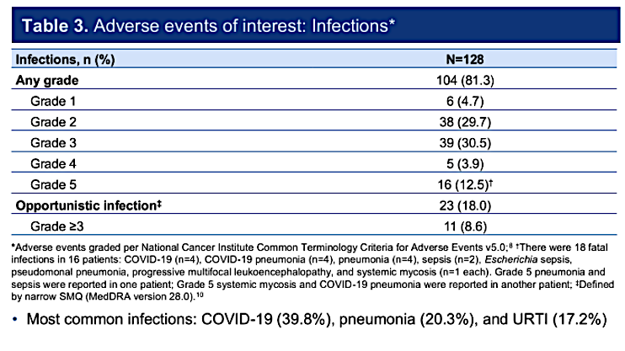
Efficacy and Safety of Long-term Odronextamab in R/R FL: Adverse Events of Interest
Bisneto, JV, et al, ASH 2025

Slide 88
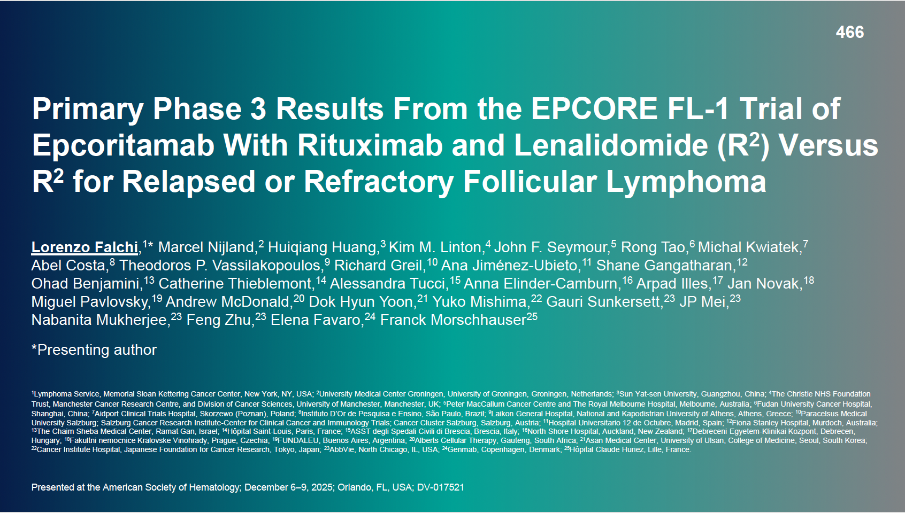

Slide 89
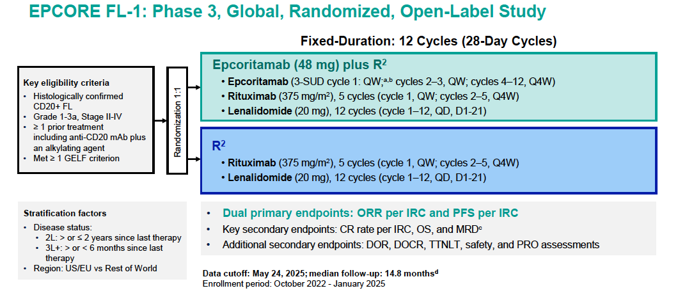
Falchi, L, et al, ASH 2025

Slide 90
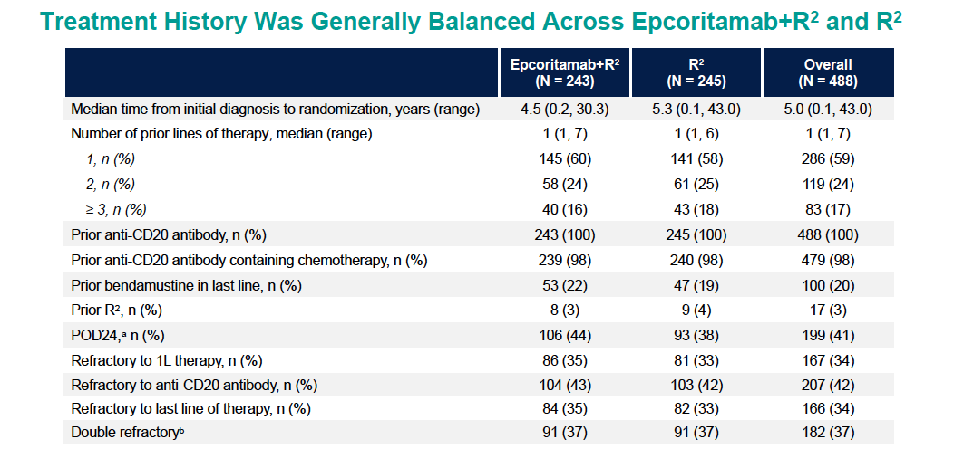
Falchi, L, et al, ASH 2025

Slide 91
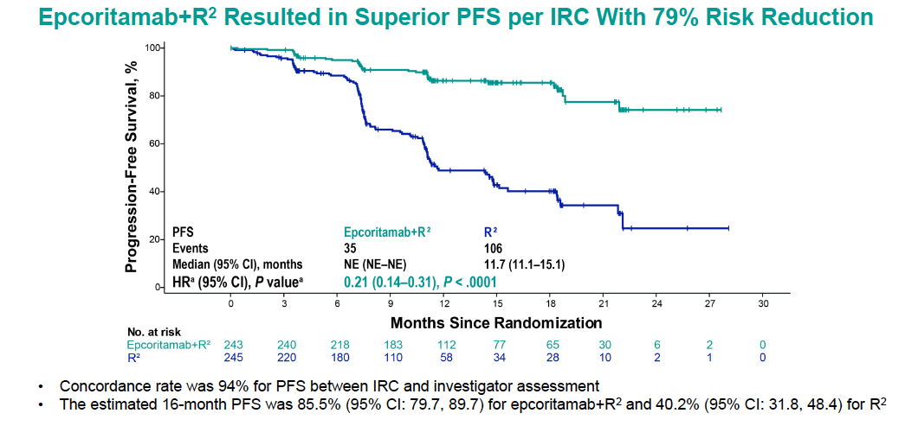
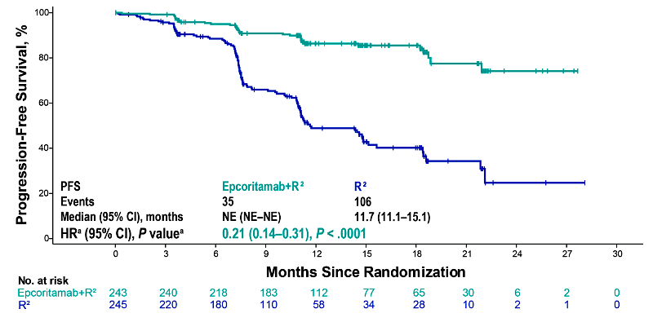
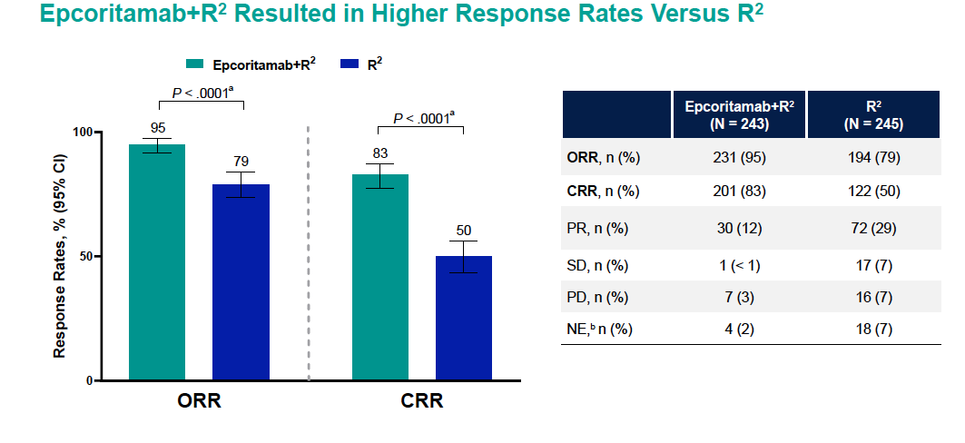
Median Follow-up Epco+R²: 14.4m; R² 11.5 m
Falchi, L, et al, ASH 2025

Slide 92
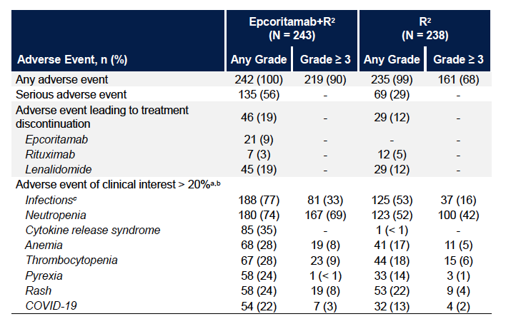
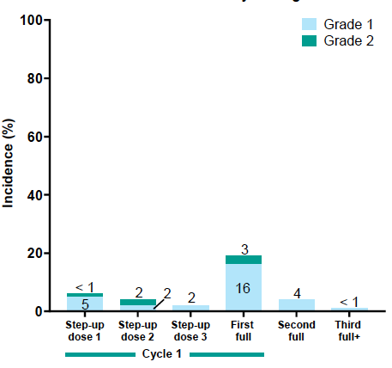
EPCORE FL-1: Safety
Falchi, L, et al, ASH 2025

Slide 93
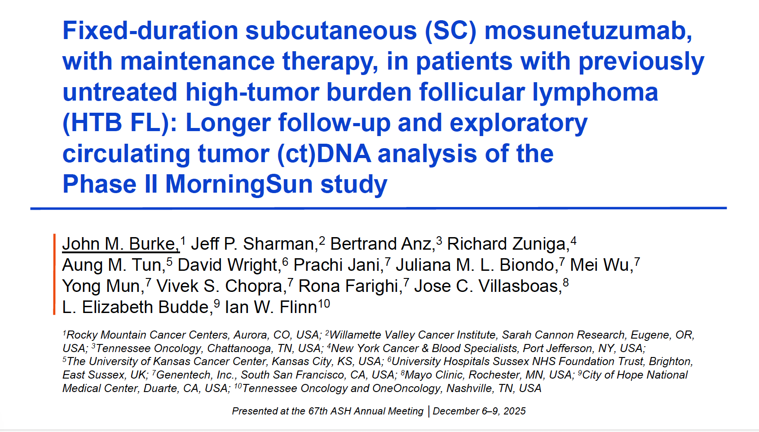

Slide 94
MorningSun Phase II Study: SC Mosun in 1L High Tumour Burden FL Cohort
Key inclusion criteria
Mosunetuzumab SC administration
Previously untreated FL
HTB by GELF criteria
ECOG performance status 0–2
D15: 45mg
D1: 45mg
D1: 45mg
CRS mitigation
Mosunetuzumab SC step-up dosing in C1
Corticosteroid prophylaxis* was mandatory in C1–2 and optional thereafter
Hospitalization was not mandatory
D8: 45mg
Patients with PMR/CMR after C17: optional maintenance therapy with mosunetuzumab SC (45mg) every 8 weeks for up to 1 year
D1: 5mg
C1
C2
C17
Endpoints
Primary: PFS rate at 24 months
Key secondary: ORR, DOR, DOCR, safety
Exploratory analysis of ctDNA levels†
21-day cycles (up to 1 year)
The HTB cohort was enrolled between March 3, 2022, and June 21, 2024 CCOD: February 10, 2025. *Dexamethasone (20mg) or methylprednisolone (80mg); premedication with oral acetaminophen or paracetamol and/or diphenhydramine could also be administered prior to administration of mosunetuzumab. †ctDNA analysis was performed using the AVENIO Oncology Assay Non-Hodgkin Lymphoma (AOA-NHL) assay.
Burke JM, et al, ASH 2025

Slide 95
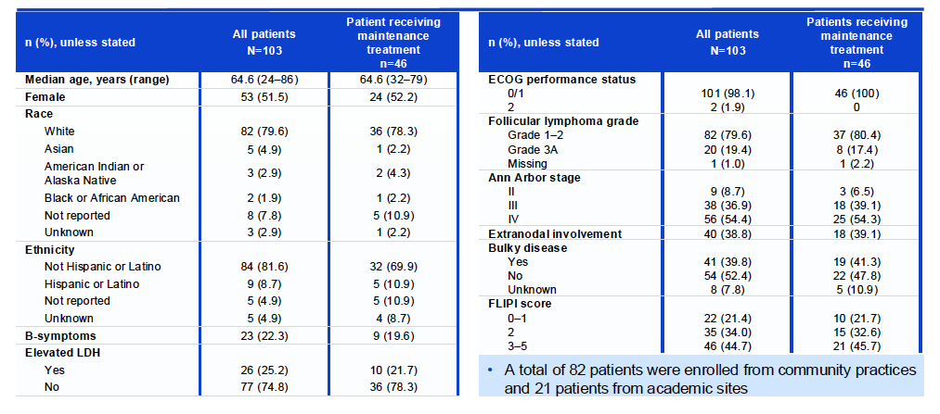

MorningSun Phase II: Study Characteristics and Response
Exploratory ctDNA analysis in a subset of patients with a CMR showed that 84.2% were MRD-negative at C4
Burke JM, et al, ASH 2025

Slide 96


MorningSun Phase II Efficacy: PFS and DOR
Survival Probability
Survival Probability
Median follow-up was 22.3 months
66.7% were eligible for maintenance, 44.7% received maintenance
No CRS occurred during maintenance
Infections were common (Gr 3-5 19.4%), no increase over time
Burke JM, et al, ASH 2025

Slide 97


Slide 98
BrUOG-401:Mosunetuzumab with response-driven lenalidomide in untreated FL and MZL
C5–C8
52 patients from 3 centers
Key eligibility criteria:..
Age ≥18 years; performance status: ECOG 0-2
CD20+ FL (G1-3A) or MZL (any subtype)
FL: GELF criteria
MZL: need to treat per investigator
No prior systemic therapy for lymphoma
No autoimmune disease, no CNS lymphoma
No immunosuppressive therapy, EBV or CMV viremia
No other concurrent malignancy, HIV,
No severe COPD, other severe comorbidities
ANC ≥ 1 x10⁹/L, Hgb ≥ 9 g/dL, platelets ≥75 x10⁹/L
Primary endpoint: CR at end of therapy
Lugano or International SMZL criteria;
gastric MALT lymphoma: confirmed with endoscopy
Toxicity rates
PFS; POD24, OS, DOR/CR
Exploratory biomarkers
Study schema
Mosun
End of treatment
Follow up
C1–C4
CR
Scan
Mosun
Scan
CR
C9–C12
Mosun +
Lenalidomide augmentation
Mosun +
Lenalidomide
extended augmentation
Scan
PR
Scan
PR/SD
PD
Off study
PD
Mosunetuzumab:..
Subcutaneous
Cycle 1 step-up dosing:
Day 1: 5 mg, D8/15: 45 mg
Cycle 2-8 (or 12): Day1, 45 mg
Dexamethasone premedication in C1, C2
Lenalidomide:..
Response-adapted after C4
10 mg daily continuous dosing
Optional extension through C12
Primary hypothesis: 80% power, one-sided α 0.047, n=52 (two-stage design)
CR at EOT >53% using RELEVANCE CT criteria
PET CT criteria for EOT response reporting
Olszewski A, et al, ASH 2025

Slide 99



BrUOG-401: Treatment Flow and Response at EOT
Olszewski A, et al, ASH 2025

Slide 100

BrUOG-401 Safety: mosunetuzumab + len augmentation
Adverse events on lenalidomide (>1 patient or G>2)
 | N | %
Lenalidomide augmentation Extended augmentation | 18 6
Any AE | 15 | 83%
Grade 3-4 AE | 8 | 44%
SAE: Muscle weakness Abdominal pain / pancreatitis AST/ALT increased Herpes zoster | 4 | 22%
Treatment discontinuation G4 hepatitis, Herpes zoster | 2 | 12%
Lenalidomide schedule: Continuous 10mg daily 14 days on / 7 days off | 12 6 | 67% 33%
Dose reduction to 5mg | 1 | 6%
Olszewski A, et al, ASH 2025

Slide 101



BrUOG-401 Efficacy: PFS
93.3%
PFS at 18 months:
83.3%
(69.2-91.3)
78.2%
Log-rank P=0.08
Median follow-up: 18 months
N=2 deaths: 1 from transformed lymphoma, 1 in remission
OS at 18 months: 97.8% (95%CI: 95.3-99.7)
Olszewski A, et al, ASH 2025

Slide 102


Slide 103

EPCORE NHL-2: EPCO+R² (Arm 6) or EPCO maintenance (Arm 7) in Untreated FL
Leslie, L, et al, ASH 2025

Slide 104



EPCORE NHL-2: EPCO+R² (Arm 6) Durable Responses in Untreated FL
Median follow-up: 33.2 m
Leslie, L, et al, ASH 2025

Slide 105




EPCORE NHL-2: Maintenance after SOC (Arm 7)
Median follow-up: 35 m
Leslie, L, et al, ASH 2025

Slide 106
Combined Mosunetuzumab and Zanubrutinib for the Treatment of Patients with Newly Diagnosed High-Burden Follicular Lymphoma: First Results of the Multicenter Phase 2 Mithic-FL2 Trial. Falchi L et al. ASH 2025;Abstract 4355.

Slide 107
Multicenter Phase 2 Study Overview
Eligibility:
≥18 years; ECOG PS 0-2
CD20+ previously untreated FL
G1-3A, stage II–IV
In need of therapy per GELF criteria
Endpoints:
Primary: CR per Lugano
Secondary: ORR, safety, PFS, DOR, TTNT, OS
Exploratory: PD, ctDNA monitoring
Outpatient administration:
Administration: Zanubrutinib PO; mosunetuzumab SC
Prophylaxis: Dexamethasone, anti H2, acetaminophen in C1 (and C2 if prior CRS)
VZV and PJP prophylaxis and GCSF support per treating physician
Mosunetuzumab, 5 mg SC
Mosunetuzumab, 45 mg SC
Imaging (PET/CT)
CR
Zanubrutinib 320 mg orally daily
Zanubrutinib 320 mg orally daily
Response assessment
PR
Zanubrutinib 320 mg orally daily
D-7
D1
D8
D15
1
2
3
4
5
6
7
8
9
10
11
12
13
14
15
16
17
Cycles
Cycles
≤SD
Off study
1 cycle = 21 days
Falchi, L, et al, ASH 2025

Slide 108



Mosunetuzumab + Zanubrutinib Induced Deep Responses in Most Patients
Response Type | Response Evaluable (n=51)
Overall Response | 47 (92%)
Complete Response | 42 (82%)
Partial Response | 5 (10%)
Stable Disease | 1 (2%)
Progressive Disease | 3 (6%)
Falchi, L, et al, ASH 2025

Slide 109

Most Adverse Events Were Low-Grade
No safety signals were observed for mosunetuzumab or zanubrutinib
Most AEs were grade 1-2
No patient discontinued treatment due to AEs
Other AEs of interest: 3 Patients had G3 (1) or G4 (2) neutropenia; 1 had G3 febrile neutropenia; 1 had G3 acute kidney injury in the setting of tumor ureteral compression; 1 had prostate cancer (G3), and 1 had G3 syncope
Falchi, L, et al, ASH 2025

Slide 110
Odronextamab plus Chemotherapy in Patients with Previously Untreated Follicular Lymphoma: First Results from Part 1 of the Phase 3 Olympia-2 Study. Wudhikarn K et al. ASH 2025;Abstract 3600

Slide 111



Wudhikarn, K, et al, ASH 2025

Slide 112


Edema peripheral
Wudhikarn, K, et al, ASH 2025

Slide 113

Wudhikarn, K, et al, ASH 2025

Slide 114

ASH 2025;Abstract 2295.

Slide 115


Celestimo Study Design and Baseline Characteristics
Sano D et al. ASH 2025;Abstract 2295.

Slide 116




Celestimo: Efficacy and Safety Summary
Sano D et al. ASH 2025;Abstract 2295.

Slide 117

ASH 2025;Abstract 883.

Slide 118




Definition of High Risk
Phillips, T, et al, ASH 2025

Slide 119


Phillips, T, et al, ASH 2025

Slide 120



PFS
MRD
3 deaths: 2 infection; 1 PD
Phillips, T, et al, ASH 2025

Slide 121
Expert Second Opinion: Investigators Discuss the Optimal Management of Gastrointestinal Cancers
A CME Symposium Series Held Adjunct to the 2026 ASCO® Gastrointestinal Cancers Symposium
HER2-Positive Gastrointestinal Cancers
Thursday, January 8, 2026
7:15 PM – 8:45 PM PT (10:15 PM – 11:45 PM ET)
Localized Colorectal Cancer
Thursday, January 8, 2026
7:15 PM – 8:45 PM PT (10:15 PM – 11:45 PM ET)
Advanced Gastroesophageal Cancers
Friday, January 9, 2026
6:00 PM – 8:00 PM PT (9:00 PM – 11:00 PM ET)

Slide 122
Thank you for joining us! Please take a moment to complete the survey currently up on Zoom. Your feedback is very important to us. The survey will remain open for 5 minutes after the meeting ends. Information on how to obtain CME and ABIM MOC credit is provided in the Zoom chat room. Attendees will also receive an email in 1 to 3 business days with these instructions.

