Slide 1
The Implications of Recent Datasets for the Current and
Future Management of Breast Cancer — An ASCO 2025 Review
A CME/MOC-Accredited Live Webinar
Wednesday, August 13, 2025
5:00 PM – 6:00 PM ET
Faculty
Sara A Hurvitz, MD, FACP
Sara M Tolaney, MD, MPH
Moderator
Neil Love, MD

Slide 2



Faculty
Sara A Hurvitz, MD, FACP
Professor of Medicine
Smith Family Endowed Chair in Women’s Health
Senior Vice President, Clinical Research Division
Fred Hutchinson Cancer Center
Head, Division of Hematology/Oncology
Department of Medicine
UW Medicine
Seattle, Washington
MODERATOR
Neil Love, MD
Research To Practice
Miami, Florida
Sara M Tolaney, MD, MPH
Chief, Division of Breast Oncology
Dana-Farber Cancer Institute
Associate Professor of Medicine
Harvard Medical School
Boston, Massachusetts

Slide 3
Commercial Support
This activity is supported by educational grants from AstraZeneca Pharmaceuticals LP, Gilead Sciences Inc, Lilly, and Novartis.

Slide 4
Dr Love — Disclosures
Dr Love is president and CEO of Research To Practice. Research To Practice receives funds in the form of educational grants to develop CME activities from the following companies: Aadi Bioscience, AbbVie Inc, ADC Therapeutics, Alexion Pharmaceuticals, Amgen Inc, Array BioPharma Inc, a subsidiary of Pfizer Inc, Arvinas, Astellas, AstraZeneca Pharmaceuticals LP, Aveo Pharmaceuticals, Bayer HealthCare Pharmaceuticals, BeOne, Black Diamond Therapeutics Inc, Blueprint Medicines, Boehringer Ingelheim Pharmaceuticals Inc, Bristol Myers Squibb, Clovis Oncology, Coherus BioSciences, CTI BioPharma, a Sobi Company, Daiichi Sankyo Inc, Eisai Inc, Elevation Oncology Inc, Exact Sciences Corporation, Exelixis Inc, Genentech, a member of the Roche Group, Genmab US Inc, Geron Corporation, Gilead Sciences Inc, GSK, Hologic Inc, ImmunoGen Inc, Incyte Corporation, Ipsen Biopharmaceuticals Inc, Jazz Pharmaceuticals Inc, Johnson & Johnson, Karyopharm Therapeutics, Kite, A Gilead Company, Kura Oncology, Legend Biotech, Lilly, MEI Pharma Inc, Merck, Mersana Therapeutics Inc, Mirati Therapeutics Inc, Mural Oncology Inc, Natera Inc, Novartis, Novartis Pharmaceuticals Corporation on behalf of Advanced Accelerator Applications, Novocure Inc, Nuvalent, Pfizer Inc, Pharmacyclics LLC, an AbbVie Company, Puma Biotechnology Inc, Regeneron Pharmaceuticals Inc, Rigel Pharmaceuticals Inc, R-Pharm US, Sanofi, Seagen Inc, Servier Pharmaceuticals LLC, SpringWorks Therapeutics Inc, Stemline Therapeutics Inc, Syndax Pharmaceuticals, Taiho Oncology Inc, Takeda Pharmaceuticals USA Inc, TerSera Therapeutics LLC, and Tesaro, A GSK Company.

Slide 5
Research To Practice CME Planning Committee Members,
Staff and Reviewers
Planners, scientific staff and independent reviewers for Research To Practice have no relevant conflicts of interest to disclose.

Slide 6
Dr Hurvitz — Disclosures
Advisory Committees | BeOne, BriaCell, BridgeBio Oncology Therapeutics, Bristol Myers Squibb, Daiichi Sankyo Inc, Genentech, a member of the Roche Group, Gilead Sciences Inc, Jazz Pharmaceuticals Inc, Luminate, Mersana Therapeutics Inc, Novartis, Prelude Therapeutics
Consulting Agreements | ALX Oncology, Bayer HealthCare Pharmaceuticals, BeOne, Blueprint Medicines, EMBioSys, Jazz Pharmaceuticals Inc, Genentech, a member of the Roche Group
Contracted Research | Arvinas, AstraZeneca Pharmaceuticals LP, Bayer HealthCare Pharmaceuticals, Celcuity, Daiichi Sankyo Inc, Dantari, F Hoffmann-La Roche Ltd, G1 Therapeutics Inc, Genentech, a member of the Roche Group, Gilead Sciences Inc, GSK, Greenwich LifeSciences Inc, Jazz Pharmaceuticals Inc, Lilly, MacroGenics Inc, Menarini Group, Novartis, Orum Therapeutics, Pfizer Inc, Radius Health Inc, Sanofi, Seagen Inc, Stemline Therapeutics Inc, Zymeworks Inc
Data and Safety Monitoring Boards/Committees | Atossa Therapeutics
Nonrelevant Financial Relationships | InClin, Quantum Leap Healthcare Collaborative

Slide 7
Dr Tolaney — Disclosures
Consulting Agreements | Aadi Bioscience, Aktis Oncology, Ambrx, Artios Pharma Limited, Arvinas, AstraZeneca Pharmaceuticals LP, Avenzo Therapeutics, Bayer HealthCare Pharmaceuticals, BeOne, Bicycle Therapeutics, BioNTech SE, Blueprint Medicines, Boehringer Ingelheim Pharmaceuticals Inc, Bristol Myers Squibb, Celcuity, Circle Pharma, Cullinan Therapeutics, Daiichi Sankyo Inc, eFFECTOR Therapeutics Inc, Eisai Inc, Genentech, a member of the Roche Group, Gilead Sciences Inc, Hengrui Therapeutics Inc, Jazz Pharmaceuticals Inc, Johnson & Johnson, Launch Therapeutics, Lilly, Menarini Group, Merck, Mersana Therapeutics Inc, Natera Inc, Novartis, Pfizer Inc, Reveal Genomics, Samsung Bioepis, Seagen Inc, Stemline Therapeutics Inc, Sumitovant Biopharma, Summit Therapeutics, SystImmune Inc, Tango Therapeutics, Zuellig Pharma
Contracted Research | AstraZeneca Pharmaceuticals LP, Bristol Myers Squibb, Daiichi Sankyo Inc, Exelixis Inc, Genentech, a member of the Roche Group, Gilead Sciences Inc, Jazz Pharmaceuticals Inc, Lilly, Menarini Group, Merck, NanoString Technologies, Novartis, OncoPep, Pfizer Inc, Seagen Inc, Stemline Therapeutics Inc
Travel Support | Arvinas, Gilead Sciences Inc, Jazz Pharmaceuticals Inc, Lilly, Pfizer Inc, Roche Laboratories Inc

Slide 8
This educational activity contains discussion of
non-FDA-approved uses of agents and regimens. Please refer to official prescribing information for each product for approved indications.

Slide 9
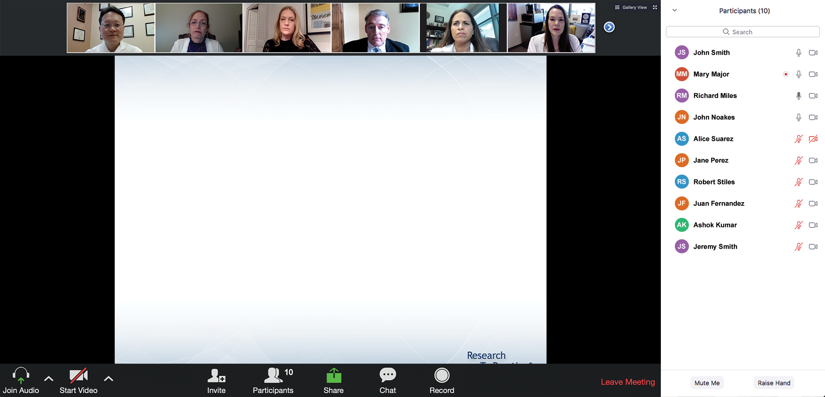

We Encourage Clinicians in Practice to Submit Questions
Feel free to submit questions now before the program begins and throughout the program.

Slide 10
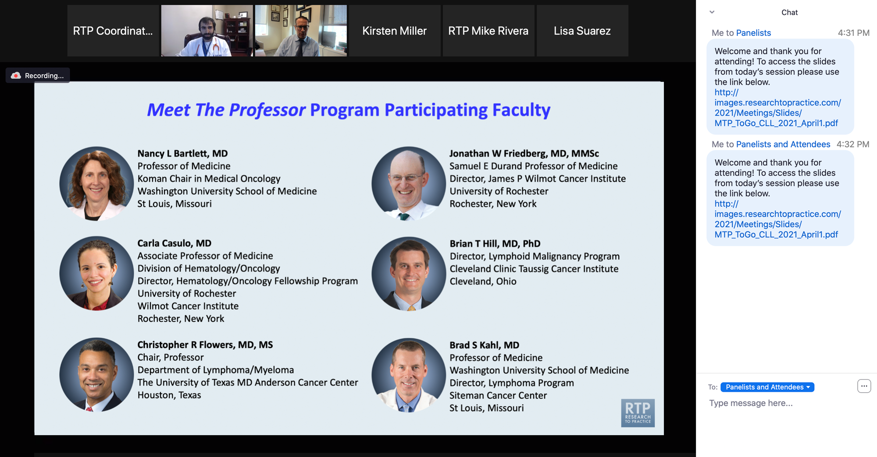
Familiarizing Yourself with the Zoom Interface
Expand chat submission box
Drag the white line above the submission box up to create
more space for your message.

Slide 11
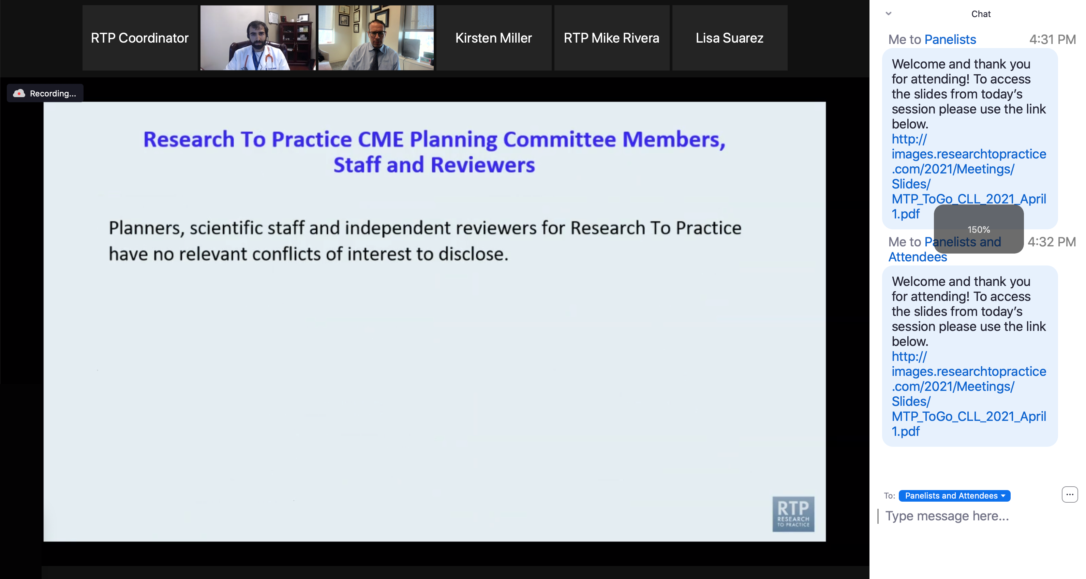
Familiarizing Yourself with the Zoom Interface
Increase chat font size
Press Command (for Mac) or Control (for PC) and the + symbol.
You may do this as many times as you need for readability.

Slide 12
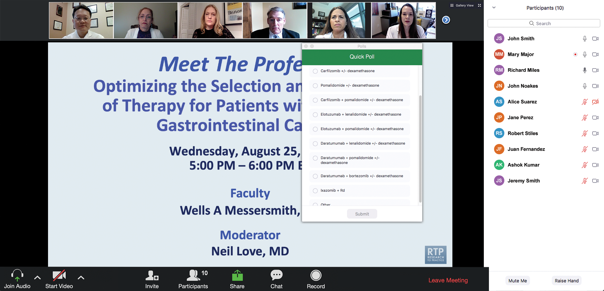
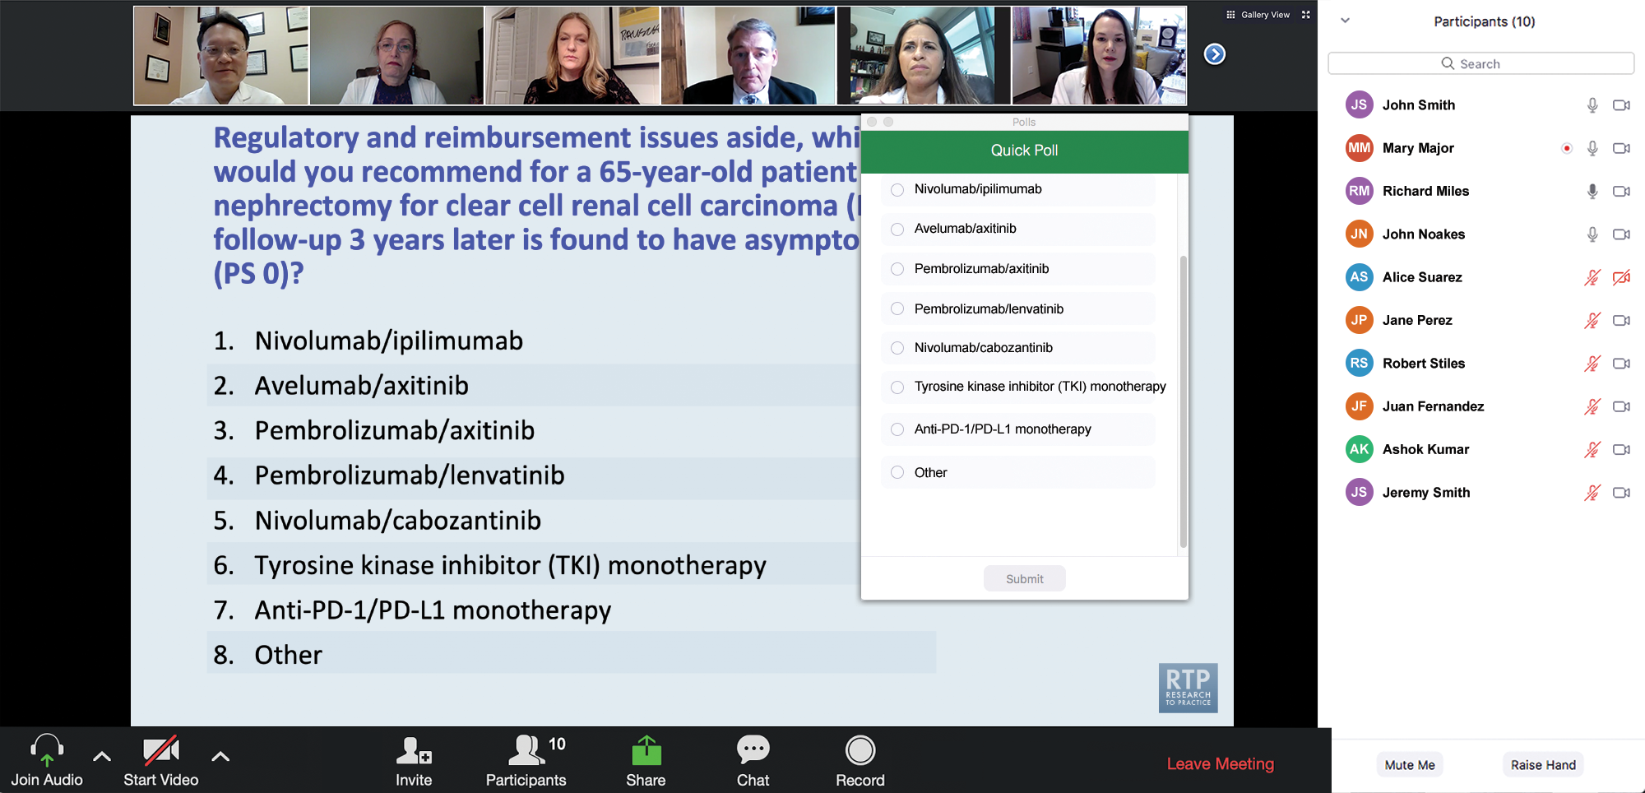
Clinicians in the Audience, Please Complete the Pre- and Postmeeting Surveys
Quick Survey
Quick Poll

Slide 13
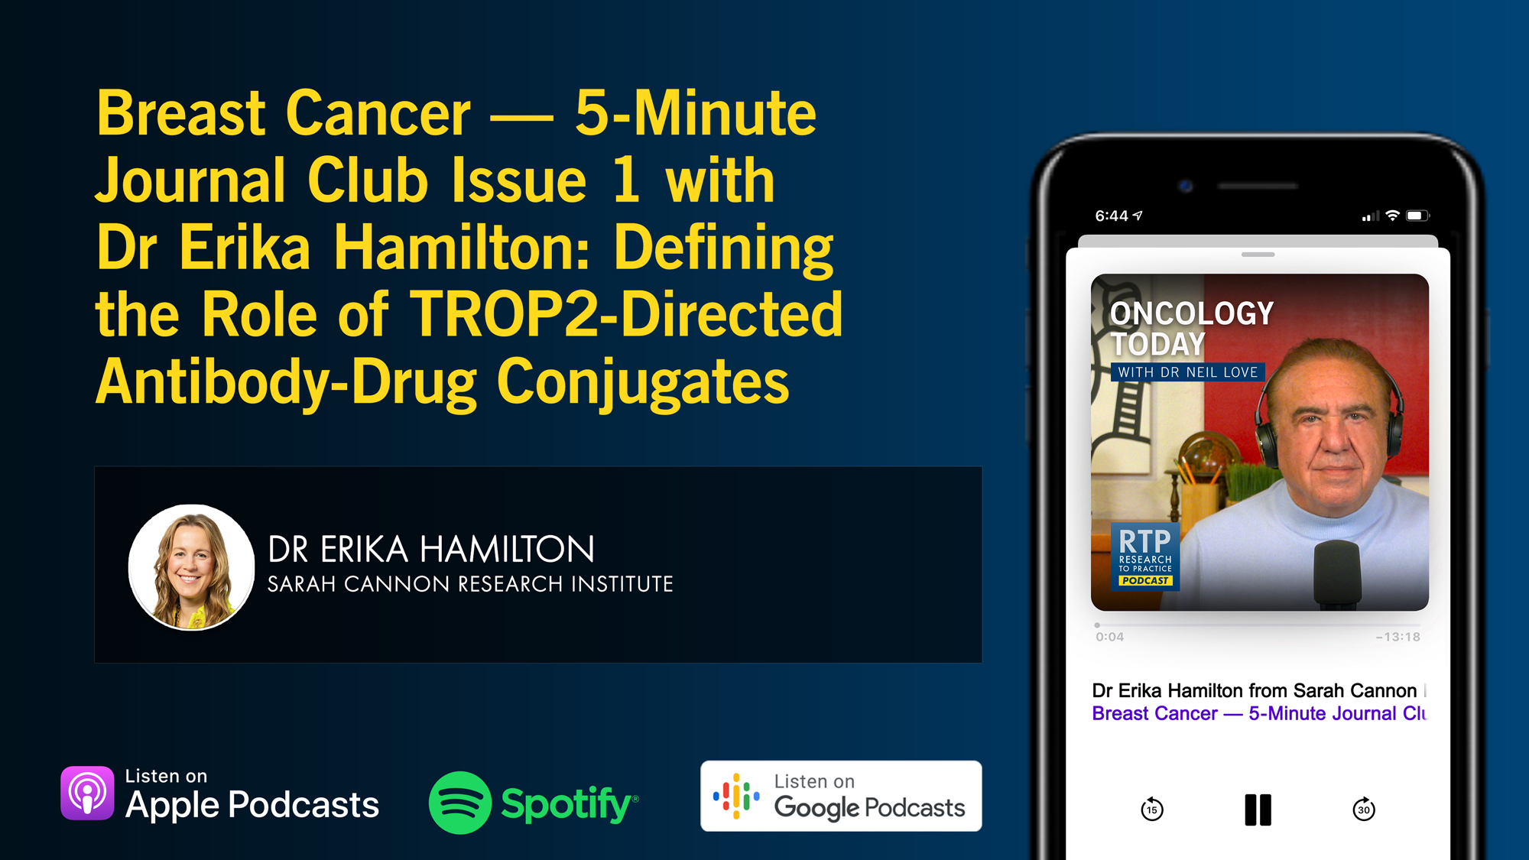

Slide 14
Selection and Sequencing of Therapy for
Metastatic Triple-Negative Breast Cancer
A CME/MOC-Accredited Live Webinar
Thursday, August 28, 2025
5:00 PM – 6:00 PM ET
Faculty
Ana C Garrido-Castro, MD
Professor Peter Schmid, FRCP, MD, PhD
Moderator
Neil Love, MD

Slide 15
Consensus or Controversy? Clinical Investigators Provide Perspectives on the Current and Future Care of Patients with Relapsed/Refractory Multiple Myeloma
Part 1 of a 2-Part CME/MOC-, NCPD- and ACPE-Accredited Satellite Symposium Series During the Society of Hematologic Oncology 2025 Annual Meeting
Thursday, September 4, 2025
6:42 PM – 7:42 PM CT
Faculty
Meletios-Athanasios (Thanos) C Dimopoulos, MD
Hans Lee, MD
Noopur Raje, MD
Moderator
Joseph Mikhael, MD, MEd

Slide 16
Consensus or Controversy? Clinical Investigators
Provide Perspectives on the Current and Future Care of Patients with Follicular Lymphoma
Part 2 of a 2-Part CME/MOC-, NCPD- and ACPE-Accredited Satellite Symposium Series During the Society of Hematologic Oncology 2025 Annual Meeting
Friday, September 5, 2025
11:47 AM – 12:47 PM CT
Faculty
Jennifer Crombie, MD
Laurie H Sehn, MD, MPH
Moderator
Jeremy S Abramson, MD, MMSc

Slide 17
Addressing Current Knowledge and Practice Gaps in the Community — Optimizing the Use of Oral Selective Estrogen
Receptor Degraders for Metastatic Breast Cancer, Part 2
A CME/MOC-Accredited Live Webinar
Wednesday, October 29, 2025
5:00 PM – 6:00 PM ET
Faculty
Rinath M Jeselsohn, MD
Joyce O’Shaughnessy, MD
Moderator
Neil Love, MD

Slide 18
Thank you for joining us! Please take a moment to complete the survey currently up on Zoom.
Your feedback is very important to us.
Information on how to obtain CME, ABIM MOC and ABS credit will be provided at the conclusion of the activity in the Zoom chat room. Attendees will also receive an email in 1 to 3 business days with these instructions.

Slide 19
The Implications of Recent Datasets for the Current and
Future Management of Breast Cancer — An ASCO 2025 Review
A CME/MOC-Accredited Live Webinar
Wednesday, August 13, 2025
5:00 PM – 6:00 PM ET
Faculty
Sara A Hurvitz, MD, FACP
Sara M Tolaney, MD, MPH
Moderator
Neil Love, MD

Slide 20
Faculty
Sara A Hurvitz, MD, FACP
Professor of Medicine
Smith Family Endowed Chair in Women’s Health
Senior Vice President, Clinical Research Division
Fred Hutchinson Cancer Center
Head, Division of Hematology/Oncology
Department of Medicine
UW Medicine
Seattle, Washington
MODERATOR
Neil Love, MD
Research To Practice
Miami, Florida
Sara M Tolaney, MD, MPH
Chief, Division of Breast Oncology
Dana-Farber Cancer Institute
Associate Professor of Medicine
Harvard Medical School
Boston, Massachusetts

Slide 21
We Encourage Clinicians in Practice to Submit Questions
Feel free to submit questions now before the program begins and throughout the program.

Slide 22
Clinicians in the Audience, Please Complete the Pre- and Postmeeting Surveys
Quick Survey
Quick Poll

Slide 24
Selection and Sequencing of Therapy for
Metastatic Triple-Negative Breast Cancer
A CME/MOC-Accredited Live Webinar
Thursday, August 28, 2025
5:00 PM – 6:00 PM ET
Faculty
Ana C Garrido-Castro, MD
Professor Peter Schmid, FRCP, MD, PhD
Moderator
Neil Love, MD

Slide 25
Consensus or Controversy? Clinical Investigators Provide Perspectives on the Current and Future Care of Patients with Relapsed/Refractory Multiple Myeloma
Part 1 of a 2-Part CME/MOC-, NCPD- and ACPE-Accredited Satellite Symposium Series During the Society of Hematologic Oncology 2025 Annual Meeting
Thursday, September 4, 2025
6:42 PM – 7:42 PM CT
Faculty
Meletios-Athanasios (Thanos) C Dimopoulos, MD
Hans Lee, MD
Noopur Raje, MD
Moderator
Joseph Mikhael, MD, MEd

Slide 26
Consensus or Controversy? Clinical Investigators
Provide Perspectives on the Current and Future Care of Patients with Follicular Lymphoma
Part 2 of a 2-Part CME/MOC-, NCPD- and ACPE-Accredited Satellite Symposium Series During the Society of Hematologic Oncology 2025 Annual Meeting
Friday, September 5, 2025
11:47 AM – 12:47 PM CT
Faculty
Jennifer Crombie, MD
Laurie H Sehn, MD, MPH
Moderator
Jeremy S Abramson, MD, MMSc

Slide 27
Addressing Current Knowledge and Practice Gaps in the Community — Optimizing the Use of Oral Selective Estrogen
Receptor Degraders for Metastatic Breast Cancer, Part 2
A CME/MOC-Accredited Live Webinar
Wednesday, October 29, 2025
5:00 PM – 6:00 PM ET
Faculty
Rinath M Jeselsohn, MD
Joyce O’Shaughnessy, MD
Moderator
Neil Love, MD

Slide 28
The Implications of Recent Datasets for the Current and
Future Management of Breast Cancer — An ASCO 2025 Review
A CME/MOC-Accredited Live Webinar
Wednesday, August 13, 2025
5:00 PM – 6:00 PM ET
Faculty
Sara A Hurvitz, MD, FACP
Sara M Tolaney, MD, MPH
Moderator
Neil Love, MD

Slide 29
Dr Hurvitz — Disclosures
Advisory Committees | BeOne, BriaCell, BridgeBio Oncology Therapeutics, Bristol Myers Squibb, Daiichi Sankyo Inc, Genentech, a member of the Roche Group, Gilead Sciences Inc, Jazz Pharmaceuticals Inc, Luminate, Mersana Therapeutics Inc, Novartis, Prelude Therapeutics
Consulting Agreements | ALX Oncology, Bayer HealthCare Pharmaceuticals, BeOne, Blueprint Medicines, EMBioSys, Jazz Pharmaceuticals Inc, Genentech, a member of the Roche Group
Contracted Research | Arvinas, AstraZeneca Pharmaceuticals LP, Bayer HealthCare Pharmaceuticals, Celcuity, Daiichi Sankyo Inc, Dantari, F Hoffmann-La Roche Ltd, G1 Therapeutics Inc, Genentech, a member of the Roche Group, Gilead Sciences Inc, GSK, Greenwich LifeSciences Inc, Jazz Pharmaceuticals Inc, Lilly, MacroGenics Inc, Menarini Group, Novartis, Orum Therapeutics, Pfizer Inc, Radius Health Inc, Sanofi, Seagen Inc, Stemline Therapeutics Inc, Zymeworks Inc
Data and Safety Monitoring Boards/Committees | Atossa Therapeutics
Nonrelevant Financial Relationships | InClin, Quantum Leap Healthcare Collaborative

Slide 30
Dr Tolaney — Disclosures
Consulting Agreements | Aadi Bioscience, Aktis Oncology, Ambrx, Artios Pharma Limited, Arvinas, AstraZeneca Pharmaceuticals LP, Avenzo Therapeutics, Bayer HealthCare Pharmaceuticals, BeOne, Bicycle Therapeutics, BioNTech SE, Blueprint Medicines, Boehringer Ingelheim Pharmaceuticals Inc, Bristol Myers Squibb, Celcuity, Circle Pharma, Cullinan Therapeutics, Daiichi Sankyo Inc, eFFECTOR Therapeutics Inc, Eisai Inc, Genentech, a member of the Roche Group, Gilead Sciences Inc, Hengrui Therapeutics Inc, Jazz Pharmaceuticals Inc, Johnson & Johnson, Launch Therapeutics, Lilly, Menarini Group, Merck, Mersana Therapeutics Inc, Natera Inc, Novartis, Pfizer Inc, Reveal Genomics, Samsung Bioepis, Seagen Inc, Stemline Therapeutics Inc, Sumitovant Biopharma, Summit Therapeutics, SystImmune Inc, Tango Therapeutics, Zuellig Pharma
Contracted Research | AstraZeneca Pharmaceuticals LP, Bristol Myers Squibb, Daiichi Sankyo Inc, Exelixis Inc, Genentech, a member of the Roche Group, Gilead Sciences Inc, Jazz Pharmaceuticals Inc, Lilly, Menarini Group, Merck, NanoString Technologies, Novartis, OncoPep, Pfizer Inc, Seagen Inc, Stemline Therapeutics Inc
Travel Support | Arvinas, Gilead Sciences Inc, Jazz Pharmaceuticals Inc, Lilly, Pfizer Inc, Roche Laboratories Inc

Slide 31
Dr Love — Disclosures
Dr Love is president and CEO of Research To Practice. Research To Practice receives funds in the form of educational grants to develop CME activities from the following companies: Aadi Bioscience, AbbVie Inc, ADC Therapeutics, Alexion Pharmaceuticals, Amgen Inc, Array BioPharma Inc, a subsidiary of Pfizer Inc, Arvinas, Astellas, AstraZeneca Pharmaceuticals LP, Aveo Pharmaceuticals, Bayer HealthCare Pharmaceuticals, BeOne, Black Diamond Therapeutics Inc, Blueprint Medicines, Boehringer Ingelheim Pharmaceuticals Inc, Bristol Myers Squibb, Clovis Oncology, Coherus BioSciences, CTI BioPharma, a Sobi Company, Daiichi Sankyo Inc, Eisai Inc, Elevation Oncology Inc, Exact Sciences Corporation, Exelixis Inc, Genentech, a member of the Roche Group, Genmab US Inc, Geron Corporation, Gilead Sciences Inc, GSK, Hologic Inc, ImmunoGen Inc, Incyte Corporation, Ipsen Biopharmaceuticals Inc, Jazz Pharmaceuticals Inc, Johnson & Johnson, Karyopharm Therapeutics, Kite, A Gilead Company, Kura Oncology, Legend Biotech, Lilly, MEI Pharma Inc, Merck, Mersana Therapeutics Inc, Mirati Therapeutics Inc, Mural Oncology Inc, Natera Inc, Novartis, Novartis Pharmaceuticals Corporation on behalf of Advanced Accelerator Applications, Novocure Inc, Nuvalent, Pfizer Inc, Pharmacyclics LLC, an AbbVie Company, Puma Biotechnology Inc, Regeneron Pharmaceuticals Inc, Rigel Pharmaceuticals Inc, R-Pharm US, Sanofi, Seagen Inc, Servier Pharmaceuticals LLC, SpringWorks Therapeutics Inc, Stemline Therapeutics Inc, Syndax Pharmaceuticals, Taiho Oncology Inc, Takeda Pharmaceuticals USA Inc, TerSera Therapeutics LLC, and Tesaro, A GSK Company.

Slide 32
Commercial Support
This activity is supported by educational grants from AstraZeneca Pharmaceuticals LP, Gilead Sciences Inc, Lilly, and Novartis.
Research To Practice CME Planning Committee Members,
Staff and Reviewers
Planners, scientific staff and independent reviewers for Research To Practice have no relevant conflicts of interest to disclose.

Slide 33
This educational activity contains discussion of
non-FDA-approved uses of agents and regimens. Please refer to official prescribing information for each product for approved indications.

Slide 34
Key Datasets
Sara A Hurvitz, MD, FACP
Kalinsky K et al. Efficacy and safety of ribociclib (RIB) + nonsteroidal aromatase inhibitor (NSAI) in NATALEE: Analysis across menopausal status and age. ASCO 2025;Abstract 516.
Mayer EL et al. The TRADE study: A phase 2 trial to assess the tolerability of abemaciclib dose escalation in early-stage HR+/HER2- breast cancer. ASCO 2025;Abstract 517.
El Saghir NS et al. First-line (1L) ribociclib (RIB) + endocrine therapy (ET) vs combination chemotherapy (combo CT) in clinically aggressive hormone receptor (HR)+/HER2− advanced breast cancer (ABC): A subgroup analysis of patients (pts) with or without liver metastases (mets) from RIGHT Choice. ASCO 2025;Abstract 1069.
Turner NC et al. INAVO120: Phase III trial final overall survival (OS) analysis of first-line inavolisib (INAVO)/placebo (PBO) + palbociclib (PALBO) + fulvestrant (FULV) in patients (pts) with PIK3CA-mutated, hormone receptor-positive (HR+), HER2-negative (HER2–), endocrine-resistant advanced breast cancer (aBC). ASCO 2025;Abstract 1003.
Turner NC et al. Camizestrant + CDK4/6 inhibitor (CDK4/6i) for the treatment of emergent ESR1 mutations during first-line (1L) endocrine-based therapy (ET) and ahead of disease progression in patients (pts) with HR+/HER2– advanced breast cancer (ABC): Phase 3, double-blind ctDNA-guided SERENA-6 trial. ASCO 2025;Abstract LBA4.
Curigliano G et al. Patient-reported outcomes (PROs) in patients with ER+, HER2- advanced breast cancer (ABC) treated with imlunestrant, investigator’s choice standard endocrine therapy, or imlunestrant + abemaciclib: Results from the phase III EMBER-3 trial. ASCO 2025;Abstract 1001.

Slide 35
Key Datasets
Sara A Hurvitz, MD, FACP
O’Shaughnessy J et al. Imlunestrant with or without abemaciclib in advanced breast cancer (ABC): Safety analyses from the phase III EMBER-3 trial. ASCO 2025;Abstract 1060.
Turner NC et al. Capivasertib in hormone receptor-positive advanced breast cancer. N Engl J Med 2023;388(22):2058-70.
Hamilton EP et al. Vepdegestrant, a PROTAC estrogen receptor (ER) degrader, vs fulvestrant in ER-positive/human epidermal growth factor receptor 2 (HER2)-negative advanced breast cancer: Results of the global, randomized, phase 3 VERITAC-2 study. ASCO 2025;Abstract LBA1000.
Dent RA et al. Exploratory biomarker analysis of trastuzumab deruxtecan (T-DXd) vs physician’s choice of chemotherapy (TPC) in HER2-low/ultralow, hormone receptor–positive (HR+) metastatic breast cancer (mBC) in DESTINY-Breast06 (DB-06). ASCO 2025;Abstract 1013.
De Brot M et al. Use of artificial intelligence–assistance software for HER2-low and HER2-ultralow IHC interpretation training to improve diagnostic accuracy of pathologists and expand patients’ eligibility for HER2-targeted treatment. ASCO 2025;Abstract 1014.
Bardia A et al. Datopotamab deruxtecan versus chemotherapy in previously treated inoperable/metastatic hormone receptor-positive human epidermal growth factor receptor 2-negative breast cancer: Primary results from TROPION-Breast01. J Clin Oncol 2025;43(3):285-96.

Slide 36
Key Datasets
Sara M Tolaney, MD, MPH
Tolaney SM et al. Trastuzumab deruxtecan (T-DXd) + pertuzumab (P) vs taxane + trastuzumab + pertuzumab (THP) for first-line (1L) treatment of patients (pts) with human epidermal growth factor receptor 2–positive (HER2+) advanced/metastatic breast cancer (a/mBC): Interim results from DESTINY-Breast09. ASCO 2025;Abstract LBA1008.
Rugo HS et al. Treatment rechallenge after trastuzumab-deruxtecan–related interstitial lung disease: A multi-institution cohort study. ASCO 2025;Abstract 1015.
Sammons SL et al. Brain metastases in metastatic breast cancer: Prevalence per line of treatment and cumulative incidence in a cohort of 18075 real-world patients. SABCS 2023;Abstract PS11-01.
Lin NU et al. Tucatinib versus placebo added to trastuzumab and capecitabine for patients with previously treated HER2+ metastatic breast cancer with brain metastases (HER2CLIMB). ASCO 2020;Abstract 1005.
Lin NU et al. Trastuzumab deruxtecan (T-DXd) in patients (pts) with HER2+ advanced/metastatic breast cancer (mBC) with or without brain metastases (BM): DESTINYBreast-12 primary results. ESMO 2024; Abstract LBA18.
Gao H-F et al. De-escalated neoadjuvant taxane plus trastuzumab and pertuzumab with or without carboplatin in HER2-positive early breast cancer (neoCARHP): A multicentre, open-label, randomised, phase 3 trial. ASCO 2025;Abstract LBA500.
Garber J et al. OlympiA: A phase 3, multicenter, randomized, placebo-controlled trial of adjuvant olaparib after (neo)adjuvant chemotherapy in patients with germline BRCA1 and/or BRCA2 pathogenic variants and high risk HER2-negative primary breast cancer: Longer term follow-up. SABCS 2024;Abstract GS1-09.

Slide 37
Key Datasets
Sara M Tolaney, MD, MPH
Singer CF et al. Prospective randomized phase II trial to assess the efficacy and safety of neo-adjuvant olaparib/carboplatin (OC) in comparison to docetaxel/epirubicin/cyclophosphamide (TAC) in patients with early triple-negative breast cancer (TNBC) with homologous recombination deficiency (HRD): Primary results from the ABCSG 45 trial. ASCO 2025;Abstract 510.
Tolaney SM et al. Sacituzumab govitecan (SG) + pembrolizumab (pembro) vs chemotherapy (chemo) + pembro in previously untreated PD-L1–positive advanced triple-negative breast cancer (TNBC): Primary results from the randomized phase 3 ASCENT-04/KEYNOTE-D19 study. ASCO 2025;Abstract LBA109.
Yin Y et al. Sacituzumab tirumotecan (sac-TMT) as first-line treatment for unresectable locally advanced/metastatic triple-negative breast cancer (a/mTNBC): Initial results from the phase II OptiTROP-Breast05 study. ASCO 2025;Abstract 1019.
O’Shaughnessy J et al. HERTHENA-Breast03: A phase 2, randomized, open-label study evaluating neoadjuvant patritumab deruxtecan + pembrolizumab before or after pembrolizumab + chemotherapy for early-stage TNBC or HR-low+/HER2− breast cancer. ASCO 2025;Abstract 629.

Slide 38
Agenda
Introduction: View from Outer Space
Module 1: Hormone Receptor (HR)-Positive Breast Cancer
Module 2: HER2-Positive Breast Cancer
Module 3: Triple-Negative Breast Cancer

Slide 39
Agenda
Introduction: View from Outer Space
Module 1: HR-Positive Breast Cancer
Module 2: HER2-Positive Breast Cancer
Module 3: Triple-Negative Breast Cancer

Slide 40
Agenda
Introduction: View from Outer Space
Module 1: HR-Positive Breast Cancer
Module 2: HER2-Positive Breast Cancer
Module 3: Triple-Negative Breast Cancer

Slide 41


Post-ASCO Review
Sara A. Hurvitz, MD, FACP
Professor of Medicine
Head, Division of Hematology/Oncology,
University of Washington School of Medicine
Senior Vice President, Clinical Research Division,
Fred Hutchinson Cancer Center
Notes:
O'Shaughnessy J et al. Imlunestrant with or without abemaciclib in advanced breast cancer (ABC): Safety analyses from the phase III EMBER-3 trial. ASCO 2025;Abstract 1060.
In addition to the abstracts listed, please address the following topic, which was not represented at ASCO 2025:
Published efficacy and safety data with capivasertib/fulvestrant for HR-positive, HER2-negative mBC progressing on aromatase inhibitor therapy with or without a CDK4/6 inhibitor
Dent RA et al. Exploratory biomarker analysis of trastuzumab deruxtecan (T-DXd) vs physician’s choice of chemotherapy (TPC) in HER2-low/ultralow, hormone receptor–positive (HR+) metastatic breast cancer (mBC) in DESTINY-Breast06 (DB-06). ASCO 2025;Abstract 1013.
De Brot M et al. Use of artificial intelligence–assistance software for HER2-low and HER2-ultralow IHC interpretation training to improve diagnostic accuracy of pathologists and expand patients' eligibility for HER2-targeted treatment. ASCO 2025;Abstract 1014.
In addition to the abstracts listed, please address the following topic, which was not represented at ASCO 2025:
Major findings with datopotamab deruxtecan versus investigator’s choice of chemotherapy for pretreated HR-positive, HER2-negative mBC
Cases:
A patient with HR-positive breast cancer who received adjuvant ribociclib
A patient with HR-positive mBC who received imlunestrant with or without abemaciclib
A patient with HR-positive mBC who received datopotamab deruxtecan

Slide 42
NATALEE Outcome by Menopausal Status/Age
Kalinsky K et al. ASCO 2025;Abstract 516

Slide 43
NATALEE
Fewer dose discontinuations due to AE in premenopausal (16% vs 23%) and younger (<40 yo, 10.5% vs >40 yo, 17.5%)

Slide 44
TRADE Study: Dose escalation of abemaciclib
Mayer EL et al. ASCO 2025;Abstract 517

Slide 45
TRADE Results

Slide 46
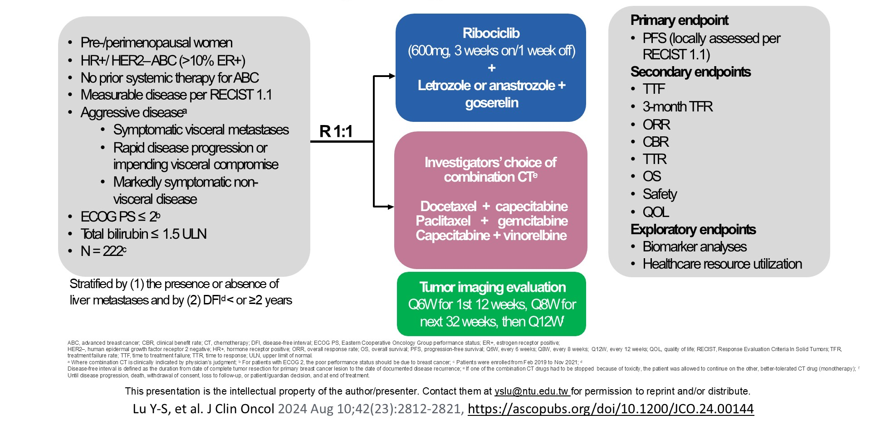
RIGHT Choice:
Outcome based on Presence of Liver Metastases

Slide 47
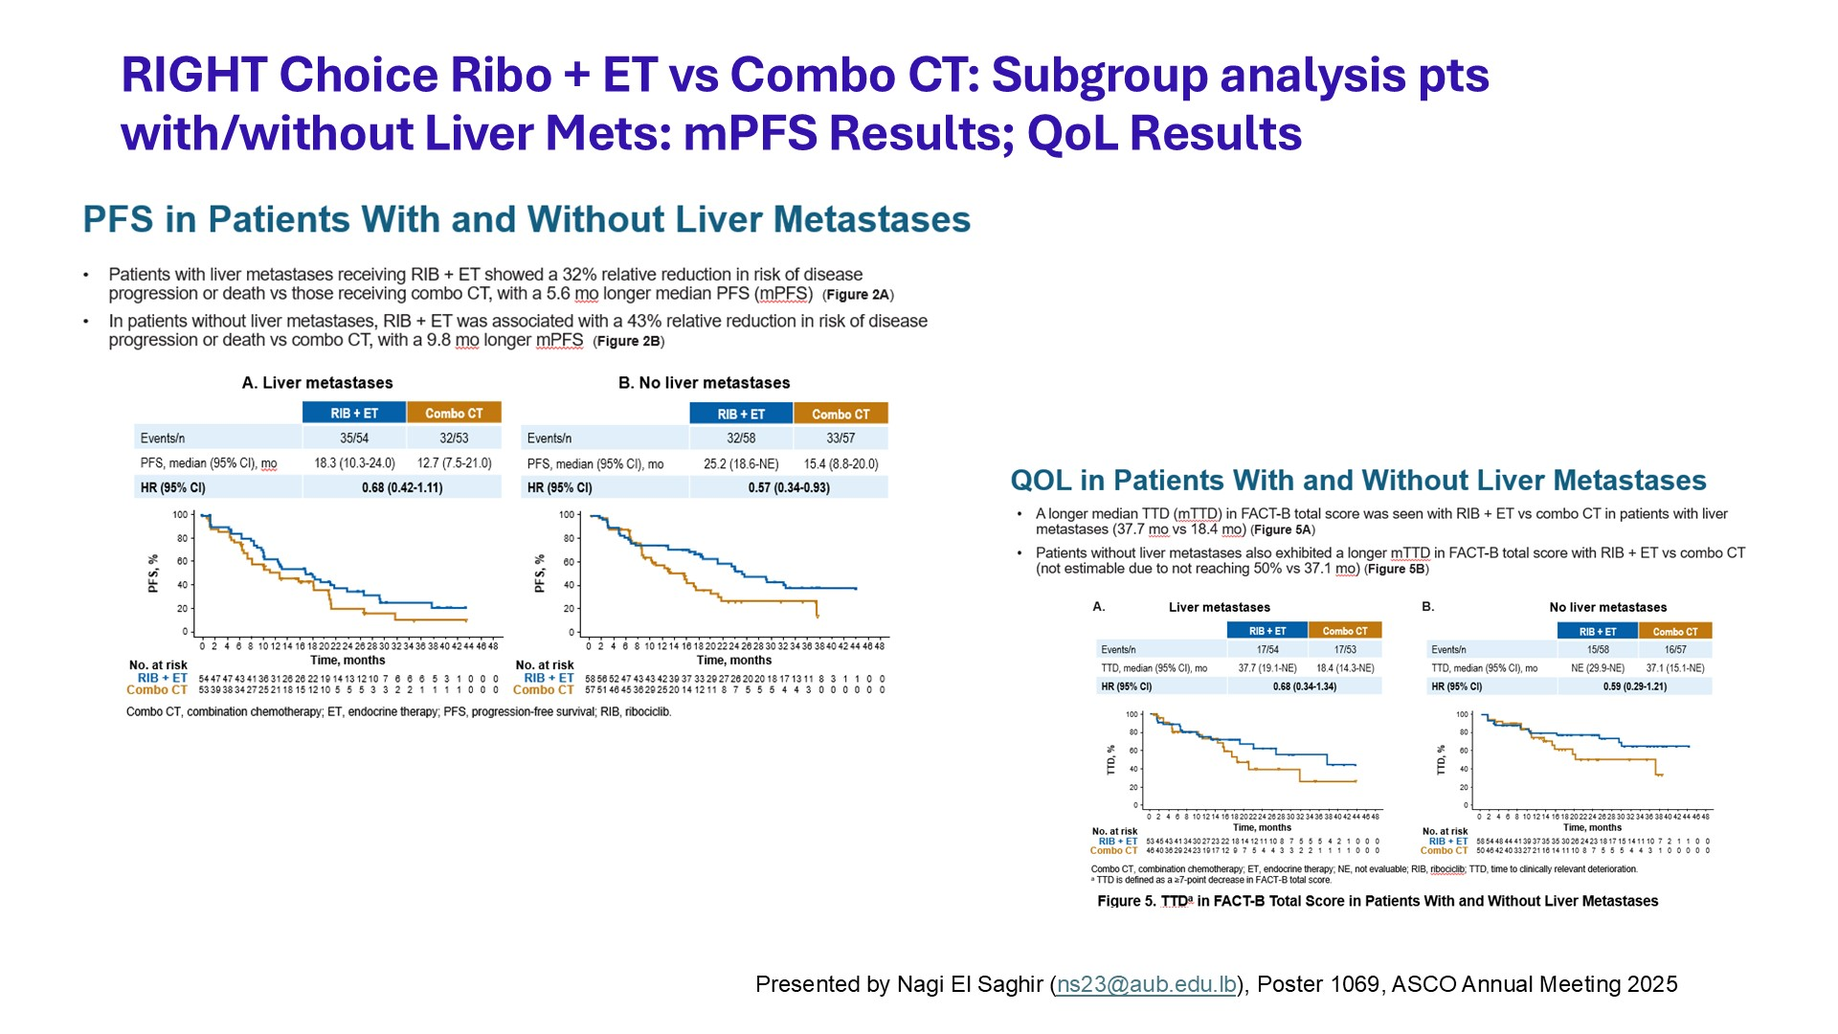
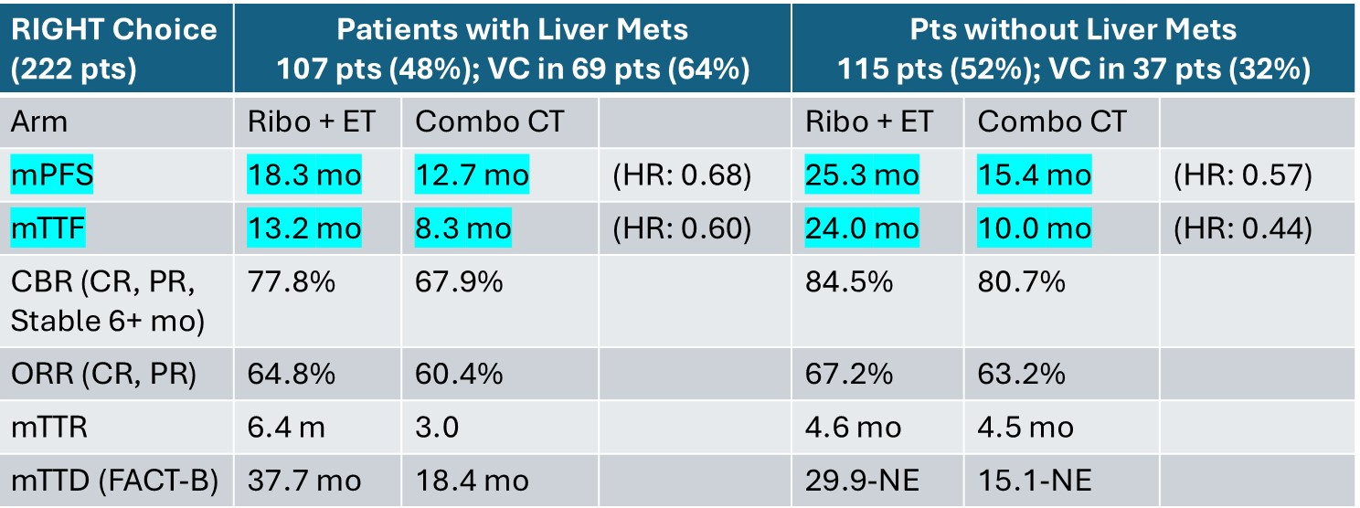
El Saghir NS et al. ASCO 2025;Abstract 1069

Slide 48
INAVO120 Overall Survival Data
Turner N et al. ASCO 2025;Abstract 1003

Slide 49
ORR 63% vs 28%
DOR 19.2 m vs 11.1 m

Slide 50
INAVO120 Updated Safety

Slide 51
SERENA-6: Using ctDNA to guide switch
Turner N et al. ASCO 2025;Abstract LBA4

Slide 54
PFS-2 in SERENA-6
Standard PFS-2
Switch to Camizestrant + CDK4/6i (2nd line rx)
3rd line rx
1L Aromatase Inhibitor (AI) +
CDK4/6 Inhibitor
1st
PD
2nd PD
R
Continue AI + CDK4/6i
2nd line
rx
2nd PD
Molecular progression
1st PD
2nd PD
PFS-1
PFS-2
Should PFS-2 include 3rd line therapy?
Is SERENA-6 PFS-2 a valid surrogate for overall survival?
Notes:
However, the SERENA-6 study design makes interpreting PFS-2 by the traditional definition challenging, because of the imbalance in the number of therapies received by the second anatomic progression. Patients on the camizestrant arm have completed three lines of therapy by PFS-2 while those on the control arm have completed only 2. This calls into question the validity of PFS-2 as a surrogate under these circumstances.

Slide 55
Lack of crossover limits clinical utility assessment
Switch to Camizestrant + CDK4/6i
1L Aromatase Inhibitor +
CDK4/6 Inhibitor
R
PFS: 16 mos
X
Molecular Progression
Continue AI + CDK4/6i
Camizestrant + CDK4/6i
PD
PFS: 9.2 mos + ?
No direct comparison of response time or overall strategy
with switch at molecular vs. anatomic progression
Notes:
But crossover to camizestrant was not allowed in SERENA-6, so we are unable to assess whether the biological hypothesis was correct, nor can we assess the overall strategy of early vs. later treatment to determine whether giving camizestrant after progression, when added the the additional time on AI would equal or even exceed the time gained by switching to camizestrant early.

Slide 56
Turner N et al. ASCO 2025;Abstract LBA4

Slide 57
EMBER-3 Safety Update
Curigliano G et al. ASCO 2025;Abstract 1001

Slide 58
EMBER-3 SAFETY
O’Shaughnessy J et al. ASCO 2025;Abstract 1060

Slide 59
EMBER-3 Patient Reported Outcomes
Curigliano G et al. ASCO 2025;Abstract 1001

Slide 60
Adjuvant CDK4/6 Inhibitor Indications
Abemaciclib
In combination with endocrine therapy (tamoxifen or an aromatase inhibitor) for the adjuvant treatment of HR-positive, HER2-negative, node-positive localized breast cancer with high risk of recurrence
Ribociclib
In combination with an aromatase inhibitor for the adjuvant treatment of HR-positive, HER2-negative Stage II and III localized breast cancer with high risk of recurrence

Slide 61
Faculty Discussion Questions
For which patients are you recommending an adjuvant CDK inhibitor (CDKi), and does this correlate with the current FDA indications? How do you choose which CDKi to use in the adjuvant setting?
Do you think the current data from SERENA-6 justify the use of serial ctDNA monitoring for patients receiving CDKi with endocrine therapy and early switching for patients with confirmed ESR1 mutations but no clinical signs of progression? If not, what outcomes would you require?
In which situations do you offer a CDKi to a patient who has already received a CDKi? Does it matter if they received the agent in the adjuvant or metastatic setting? If you could use abemaciclib/imlunestrant, in which patients, if any, would you employ it?

Slide 62
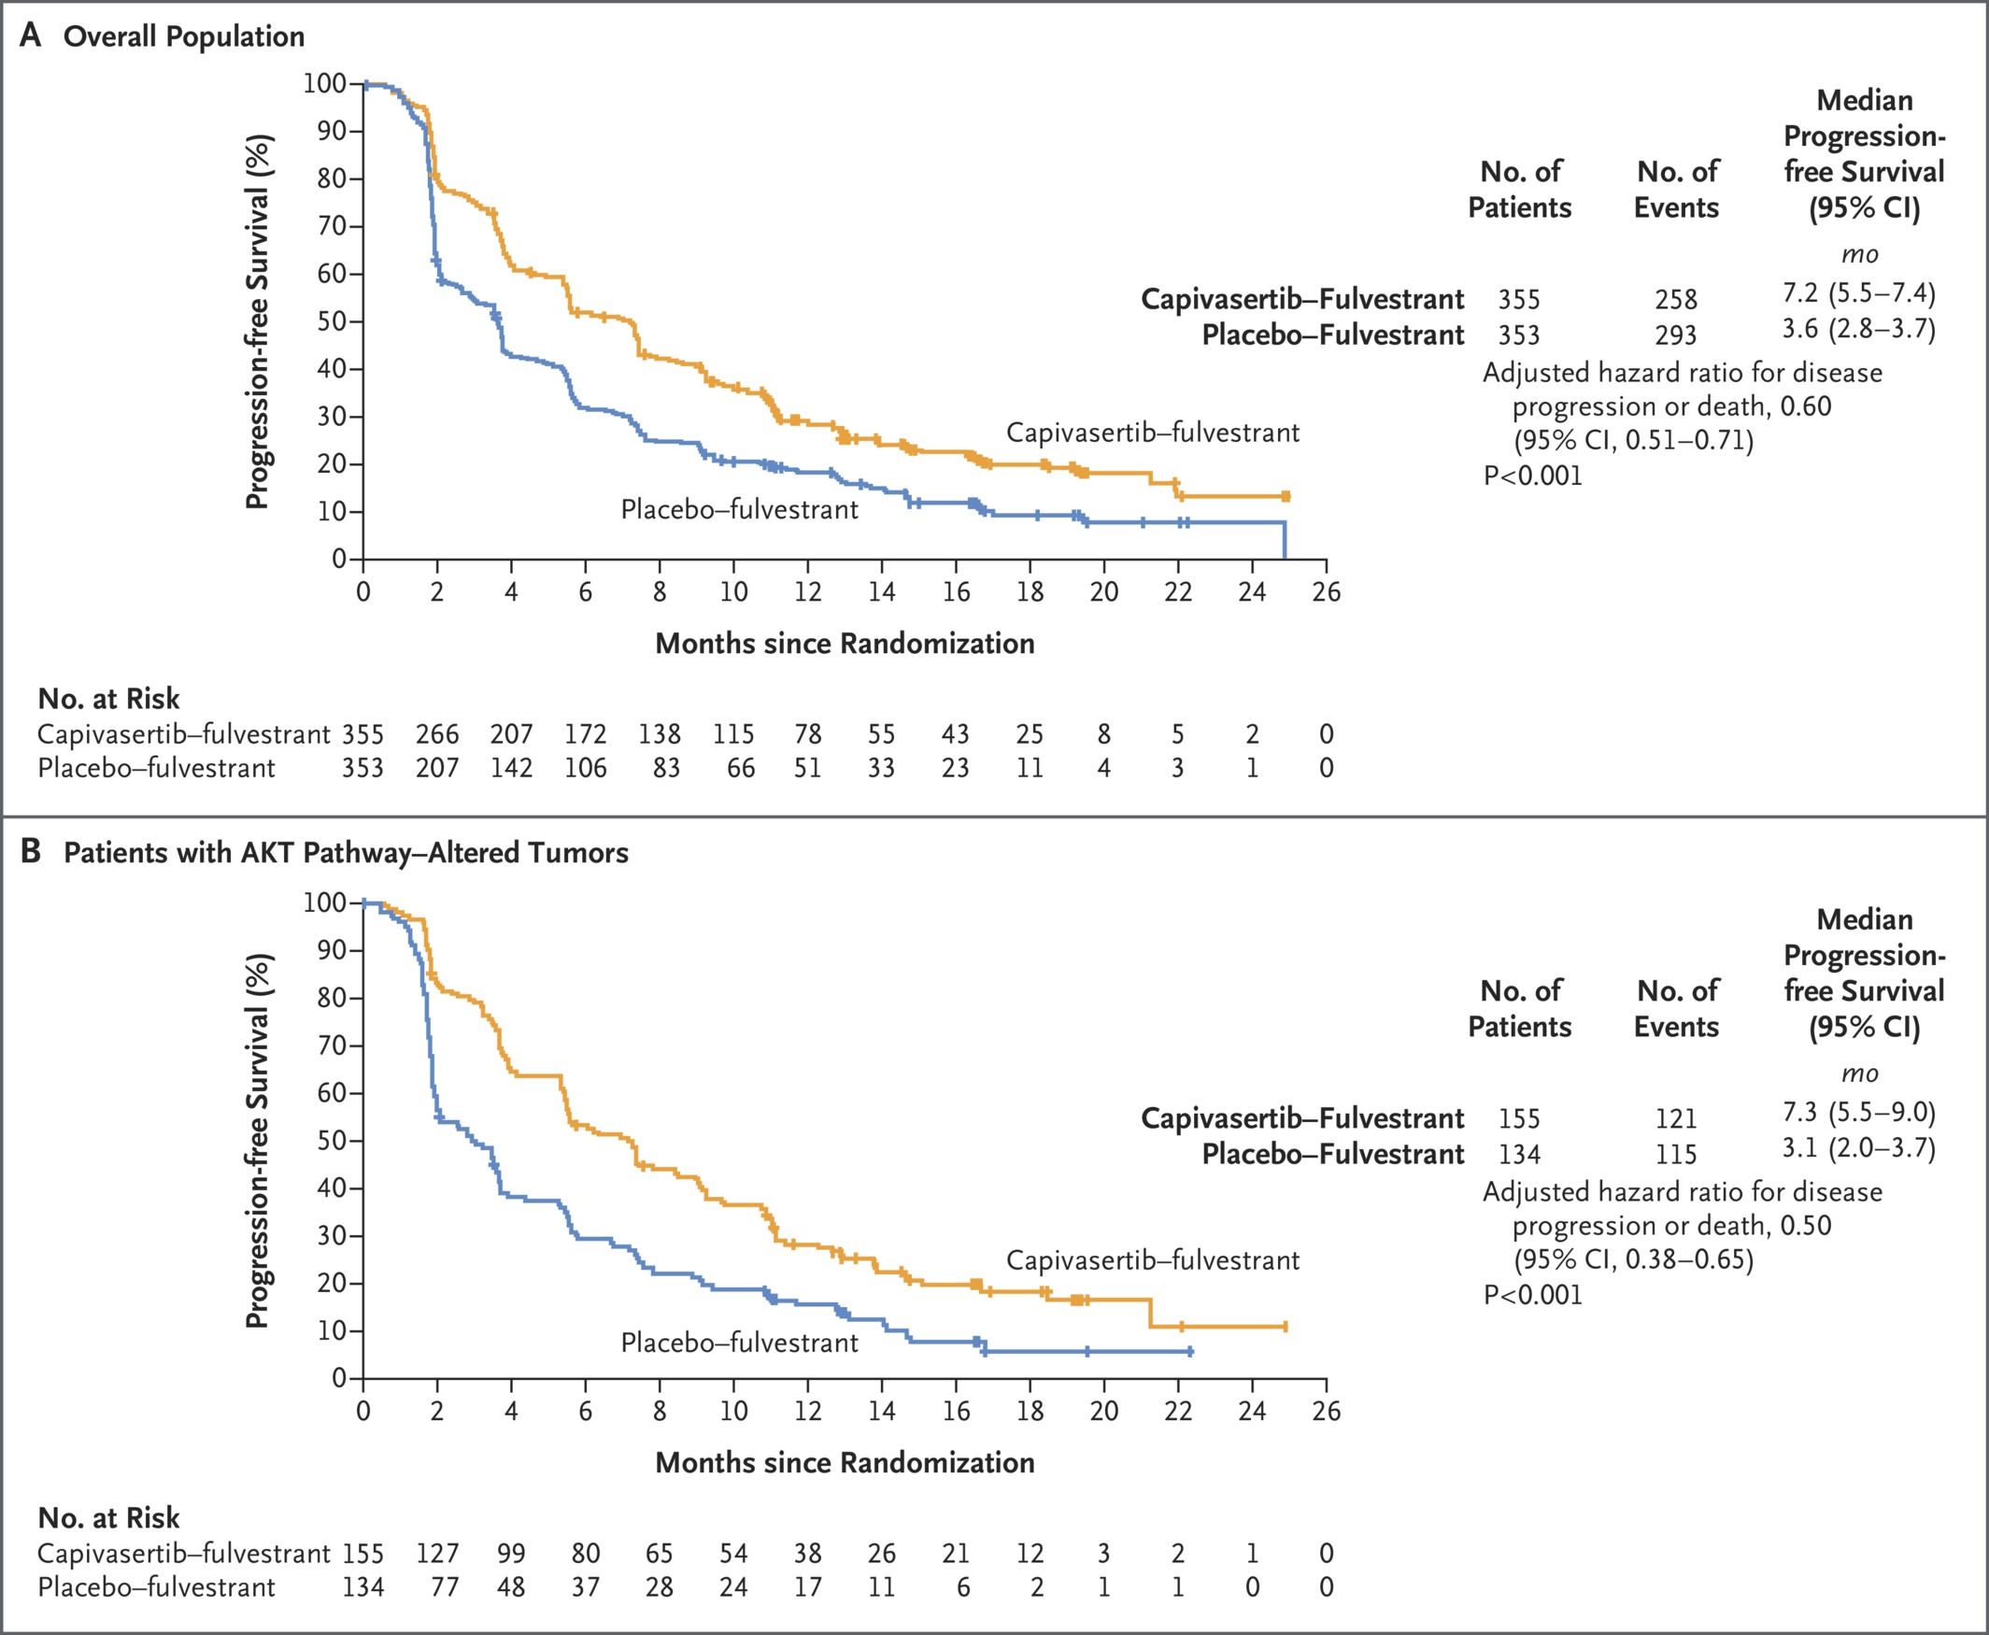
CAPItello-291: Fulvestrant + Capivasertib or Placebo
FDA approved 11/2023:
-HR+/HER2- with PIK3CA, AKT1 and/or PTEN-alteration after PD on >1 endocrine therapy in MBC (or <12 mos from adjuvant ET)
~70% prior CDK4/6i
~18% prior chemo for MBC
Overall survival not statistically significantly different
Turner NC et al. N Engl J Med2023;388:2058-2070

Slide 63
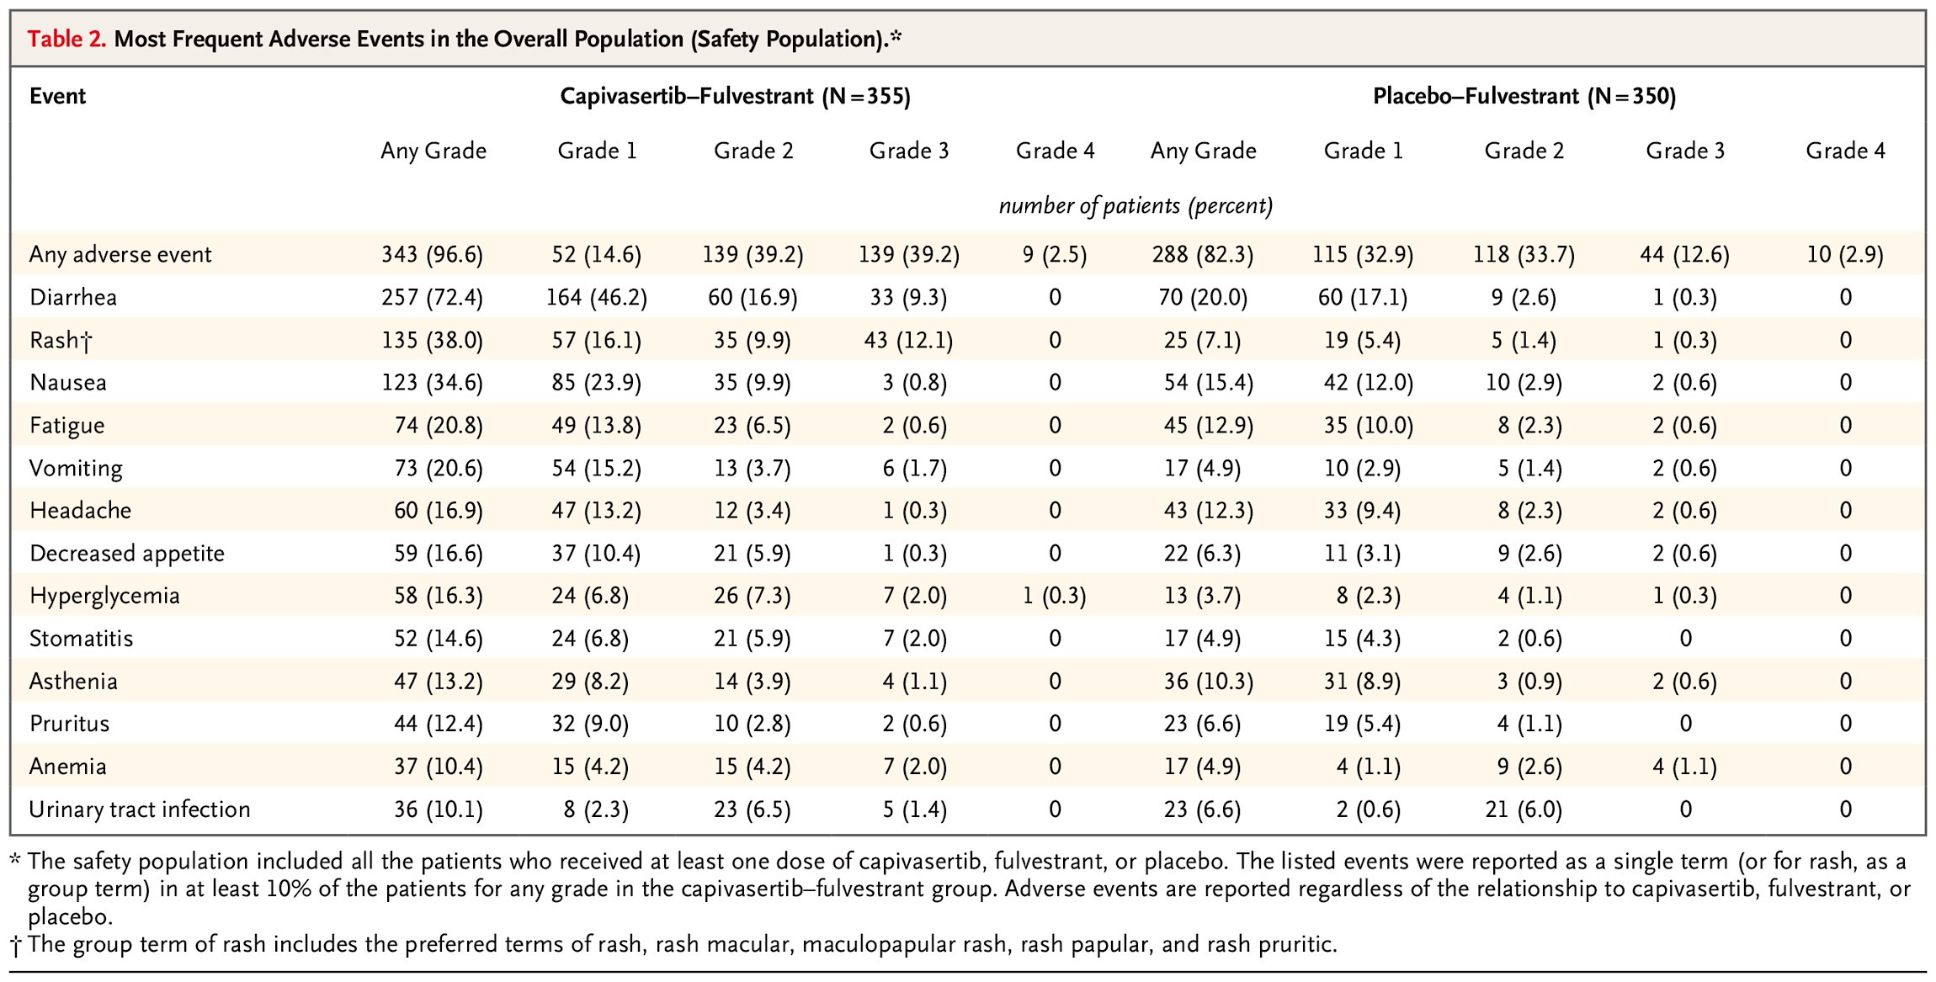
CAPItello-291: Safety
Most frequent grade >3 events in capi arm: rash (12.1% vs.0.3%) and diarrhea (9.3% vs. 0.3%)
AEs leading to discontinuation: 13.0% in capivasertib and in 2.3% in placebo
Turner NC et al. N Engl J Med2023;388:2058-2070
Notes:
Table 2 Most Frequent Adverse Events in the Overall Population (Safety Population).

Slide 64
VERITAC-2 Phase 3 Trial of Vepdegestrant
Hamilton EP et al. ASCO 2025;Abstract LBA1000

Slide 67
DESTINY-Breast06: Biomarker Results
Dent RA et al. ASCO 2025;Abstract 1013

Slide 68
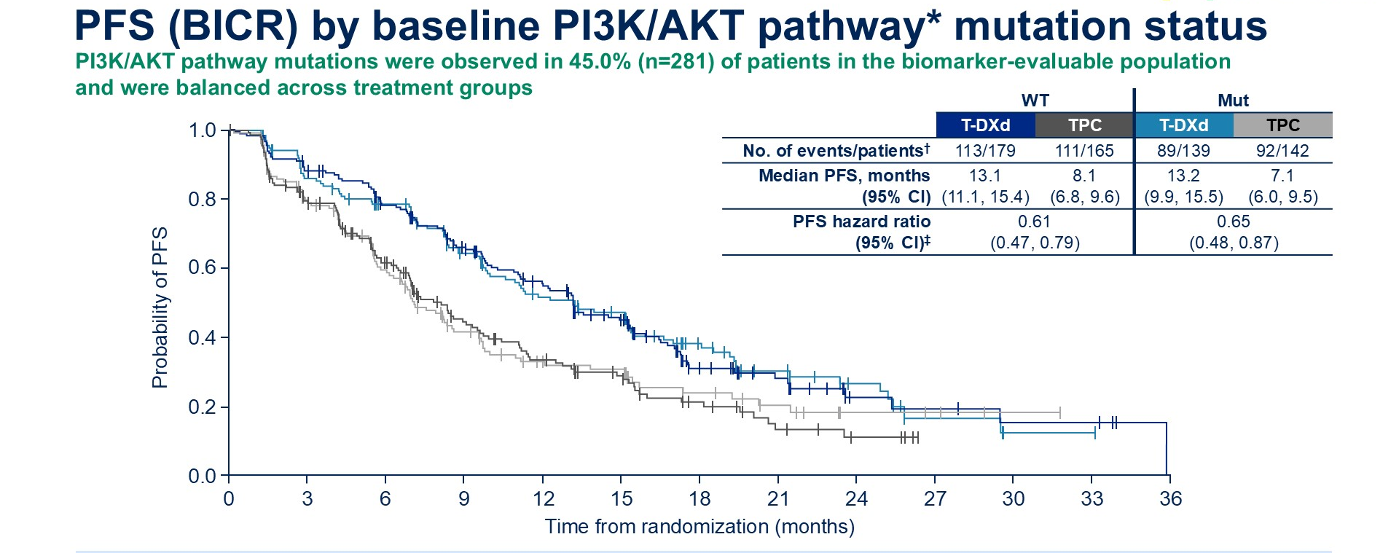
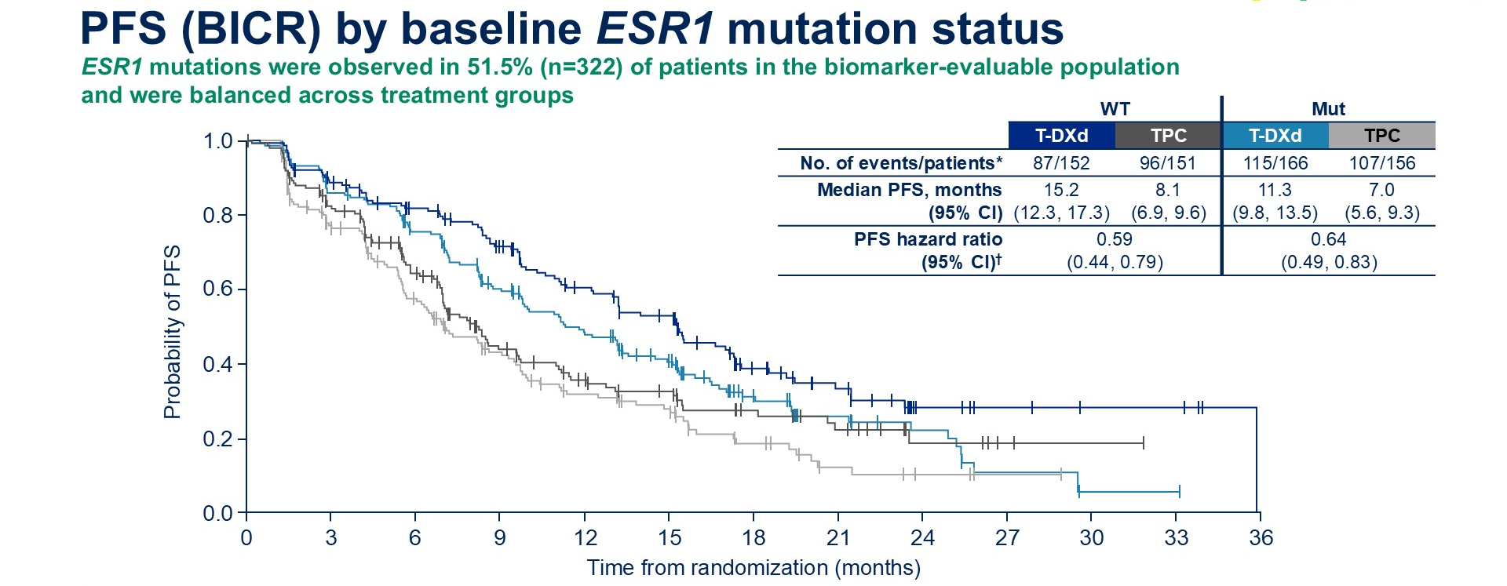
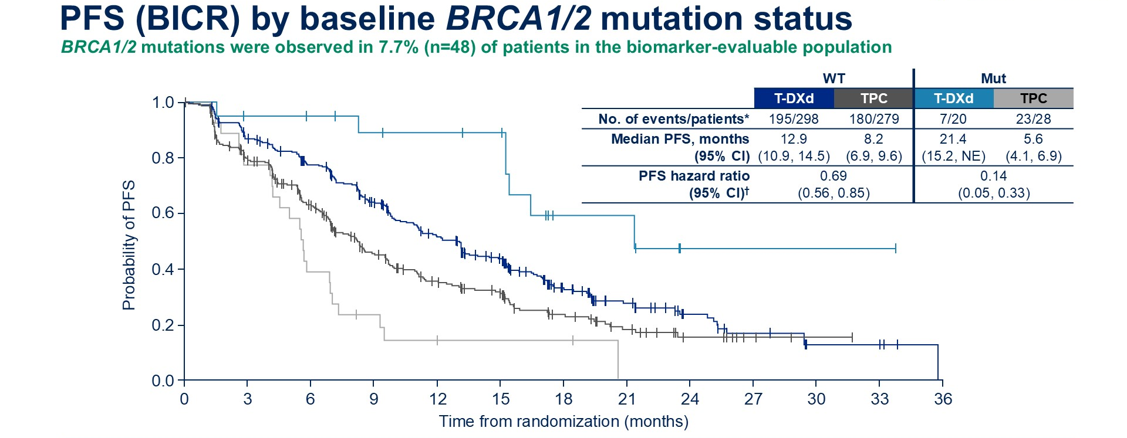
PFS (BICR) by baseline PI3K/AKT pathway* mutation status
Dent RA et al. ASCO 2025;Abstract 1013

Slide 69
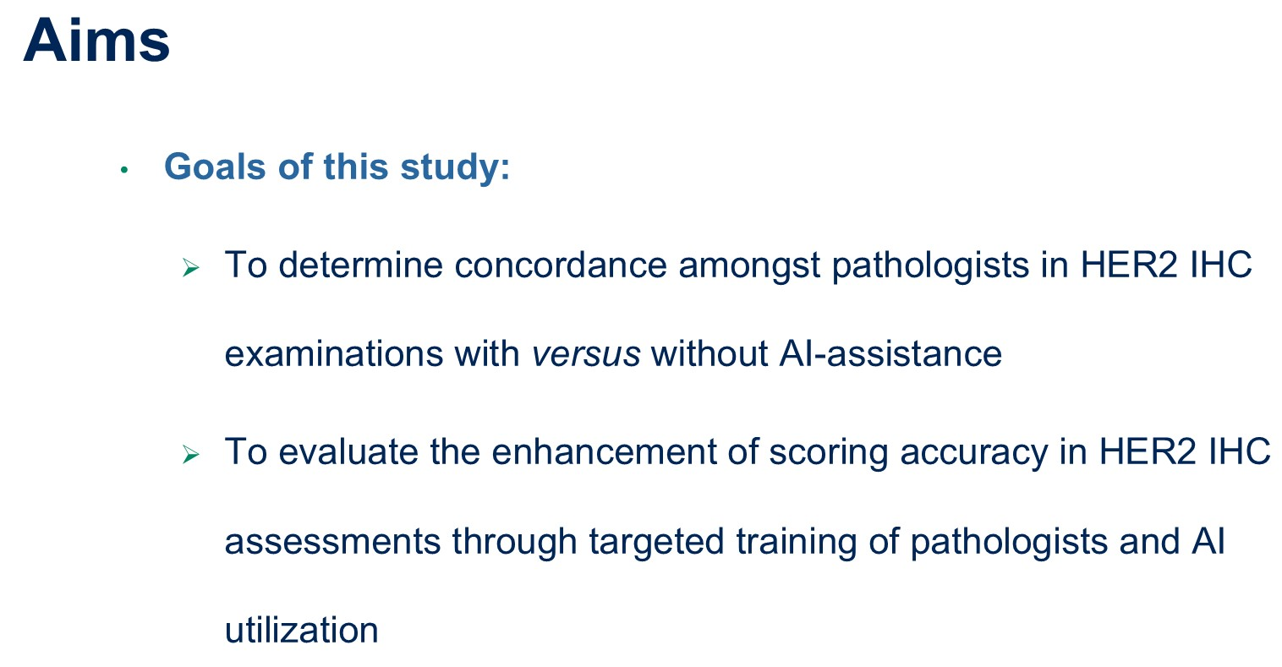
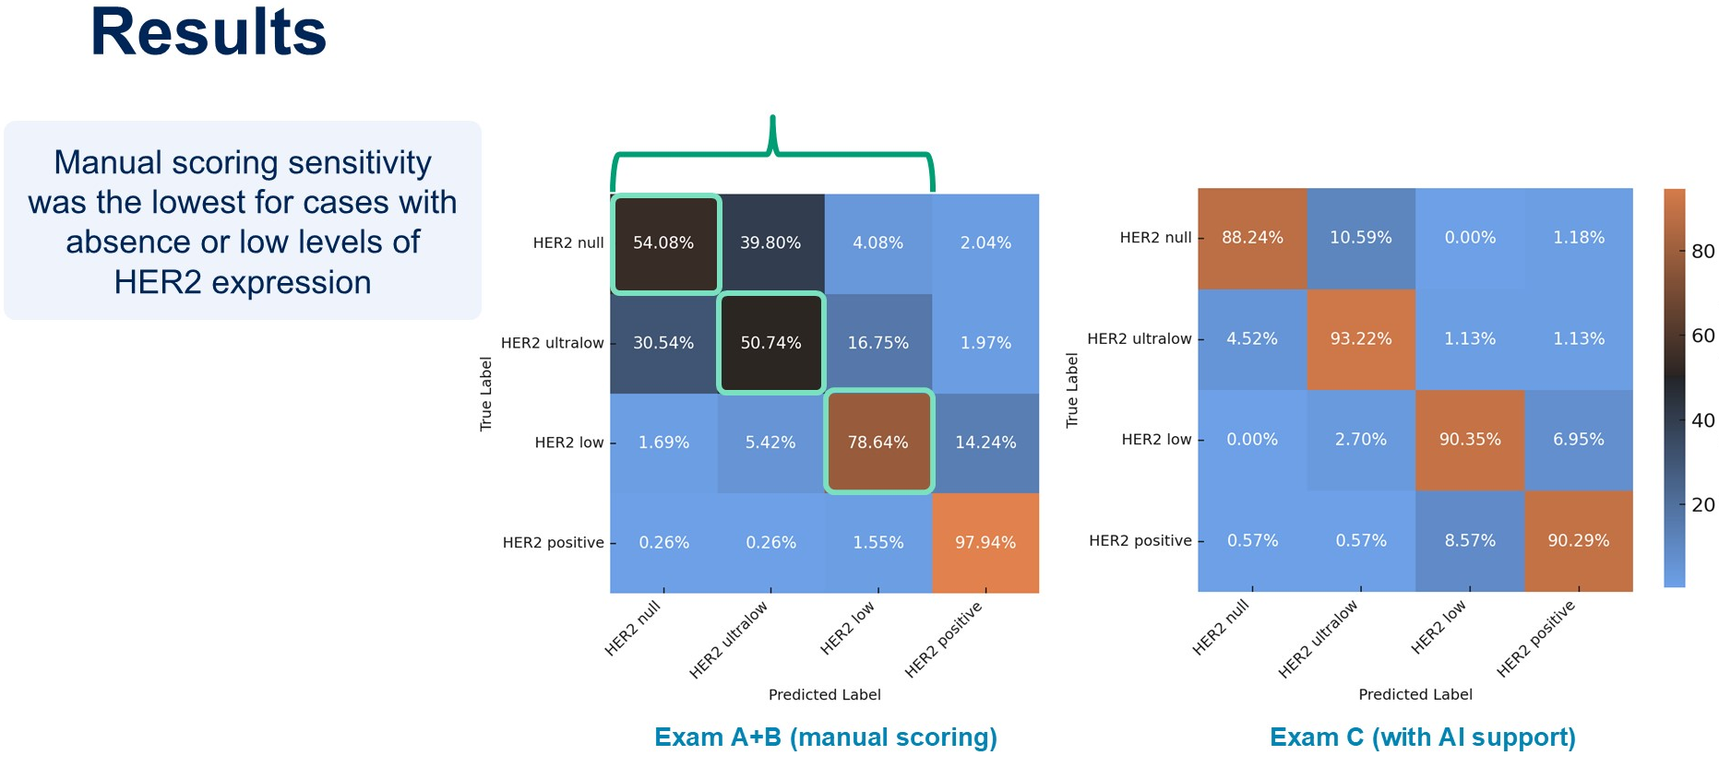
Use of AI for HER2 low and ultralow determination
DeBrot M et al. ASCO 2025;Abstract 1014

Slide 70
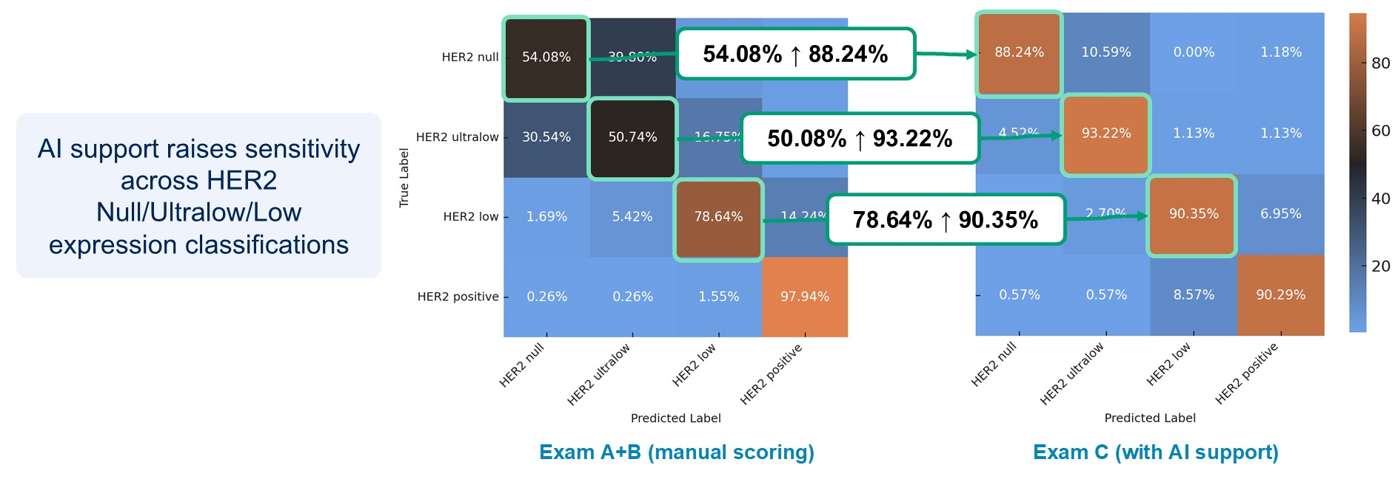
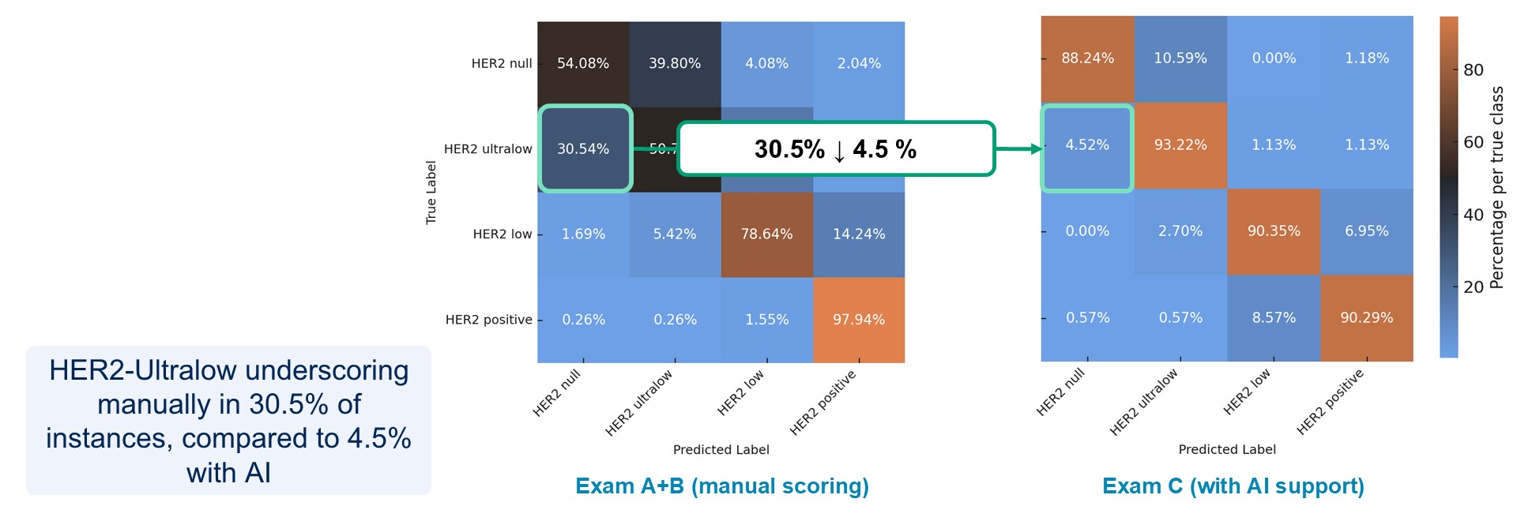
Results
DeBrot M et al. ASCO 2025;Abstract 1014

Slide 71
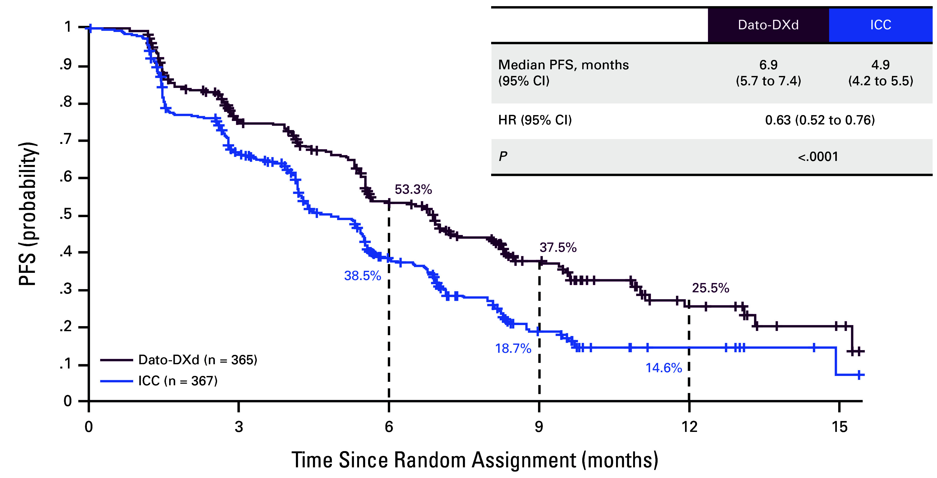
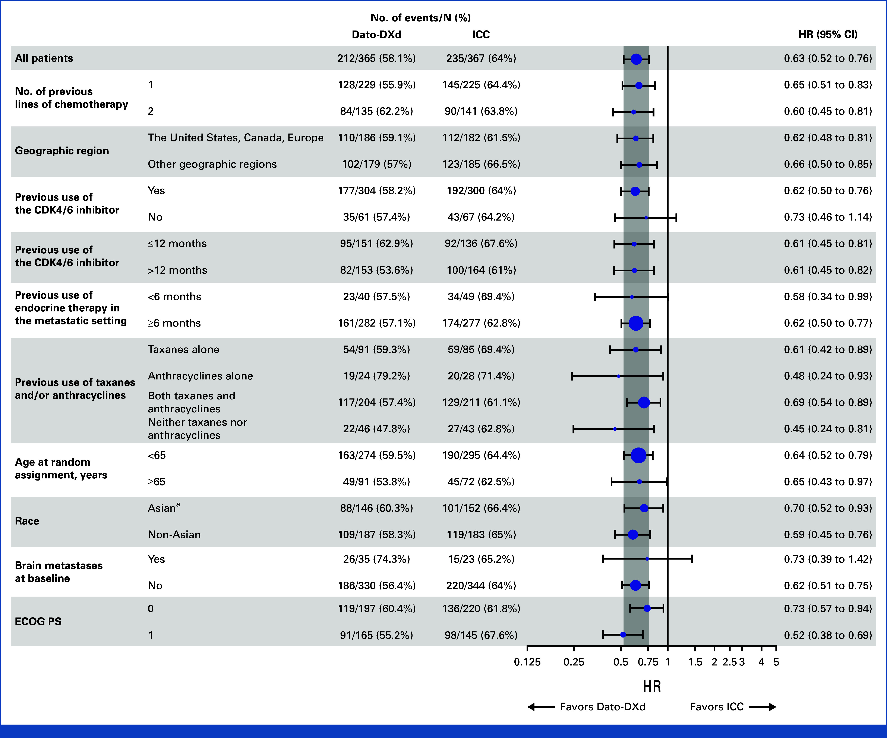
TROPION-Breast01: Datopotamab Deruxtecan in HR+ HER2 negative MBC
Bardia A et al. J Clin Oncol. 2025 Jan 20;43(3):285-296.

Slide 72
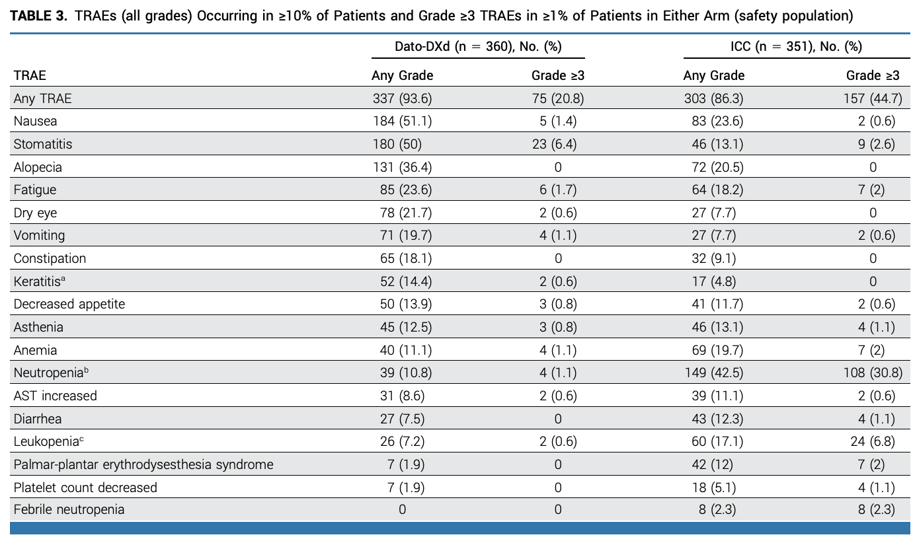
TROPION-Breast01: Datopotamab Deruxtecan
Bardia A et al. J Clin Oncol. 2025 Jan 20;43(3):285-296.

Slide 73
Faculty Discussion Questions
What second-line therapy do you typically prefer for a patient with ER-positive, ESR1-negative, PIK3CA-positive disease? What toxicities are most common with this approach? What second-line treatment do you favor for a patient with both ESR1 and PIK3CA mutations?
If elacestrant, imlunestrant or vepdegestrant were all available, which one would you likely use as second-line treatment for a patient with ESR1-positive, PIK3CA wild-type disease?
How do you typically sequence available agents/regimens for patients with ER-positive, HER2-low (IHC 1+) and ER-positive, HER2-negative (IHC 0) disease who are no longer candidates for endocrine therapy?

Slide 74
Agenda
Introduction: View from Outer Space
Module 1: HR-Positive Breast Cancer
Module 2: HER2-Positive Breast Cancer
Module 3: Triple-Negative Breast Cancer

Slide 75


HER2+ and TNBC Highlights from ASCO 2025
Sara M. Tolaney

Slide 76
DESTINY-Breast09 study design
A randomized, multicenter, open-label,* Phase 3 study (NCT04784715)
Eligibility criteria
HER2+ a/mBC
Asymptomatic/inactive brain mets allowed
DFI >6 mo from last chemotherapy or HER2-targeted therapy in neoadjuvant/ adjuvant setting
One prior line of ET for mBC permitted
No other prior systemic treatment
for mBC†
T-DXd‡ + placebo
Endpoints
Primary
PFS (BICR)
Key secondary
OS
Secondary
PFS (INV)
ORR (BICR/INV)
DOR (BICR/INV)
PFS2 (INV)
Safety and tolerability
n=387
Blinded until final PFS analysis
T-DXd‡ + pertuzumab§
R
1:1:1
n=383
THP
Taxane (paclitaxel or docetaxel)¶ + trastuzumab║ + pertuzumab§
n=387
Stratification factors
De-novo vs recurrent mBC
HR+ or HR−
PIK3CAm (detected vs non-detected)
At this planned interim analysis (DCO Feb 26, 2025), results are reported for the T-DXd + P and THP arms
*Open label for THP arm. Double blinded for pertuzumab in experimental arms; †HER2-targeted therapy or chemotherapy; ‡5.4 mg/kg Q3W; §840 mg loading dose, then 420 mg Q3W; ¶paclitaxel 80 mg/m² QW or 175 mg/m² Q3W, or docetaxel 75 mg/m² Q3W for a minimum of six cycles or until intolerable toxicity; ║8 mg/kg loading dose, then 6 mg/kg Q3W
a/mBC, advanced/metastatic breast cancer; BICR, blinded independent central review; DCO, data cutoff; DFI, disease-free interval; DOR, duration of response; HER2, human epidermal growth factor receptor 2; HER2+, HER2-positive;
HR+/−, hormone receptor–positive/–negative; INV, investigator; mBC, metastatic breast cancer; mets, metastases; mo, months; ORR, objective response rate; OS, overall survival; P, pertuzumab; PFS, progression-free survival;
PFS2, second progression-free survival; PIK3CAm, phosphatidylinositol-4,5-bisphosphate 3-kinase catalytic subunit alpha mutation; Q3W, every 3 weeks; QW, once every week; R, randomization; T-DXd, trastuzumab deruxtecan
NCT04784715. Updated. May 6, 2025. Available from: https://clinicaltrials.gov/study/NCT04784715 (Accessed May 29, 2025)
Abstract LBA1008

Slide 77
PFS (BICR): primary endpoint
 | T-DXd + P (n=383) | THP (n=387)
Median, mo (95% CI) | 40.7* (36.5, NC) | 26.9 (21.8, NC)
Hazard ratio (95% CI) | 0.56 (0.44, 0.71)
P-value | <0.00001†
1.0
93.0%
(95% CI 89.9, 95.2)
85.9%
(95% CI 81.9, 89.1)
T-DXd + P
mPFS: 40.7 mo† (95% CI 36.5, NC)
0.8
70.1%
(95% CI 64.8, 74.8)
87.8%
(95% CI 84.0, 90.7)
0.6
72.4%
(95% CI 67.4, 76.8)
Δ 13.8 mo
Probability of PFS
THP
mPFS: 26.9 mo
(95% CI 21.8, NC)
0.4
52.1%
(95% CI 46.4, 57.5)
Hazard ratio 0.56
95% CI 0.44, 0.71
P-value <0.00001*
Hazard ratio 0.56
95% CI 0.44, 0.71
P-value <0.00001*
0.2
0
0
3
6
9
12
15
18
21
24
27
30
33
36
39
42
45
48
Time from randomization (months)
No. at risk
T-DXd + P
383
358
355
321
293
275
242
208
175
153
82
49
21
10
3
0
387
353
312
273
241
215
187
160
124
106
51
32
12
5
1
0
THP
Statistically significant and clinically meaningful PFS benefit with T-DXd + P (median Δ 13.8 mo)
*Median PFS estimate for T-DXd + P is likely to change at updated analysis; †stratified log-rank test. A P-value of <0.00043 was required for interim analysis superiority
BICR, blinded independent central review; CI, confidence interval; mo, months; (m)PFS, (median) progression-free survival; NC, not calculable; P, pertuzumab; T-DXd, trastuzumab deruxtecan; THP, taxane + trastuzumab + pertuzumab
Abstract LBA1008

Slide 78
Conclusions
  T-DXd + P demonstrated a statistically significant and clinically meaningful PFS benefit by BICR vs THP, which was consistently
  observed across subgroups
    Hazard ratio of 0.56 vs THP (P<0.00001)
    Median PFS was 40.7 months (T-DXd + P) vs 26.9 months (THP)
  Median DOR of >3 years with T-DXd + P, with CRs in 15.1% (T-DXd + P)
  vs 8.5% (THP)
  Early OS data suggest a positive trend favoring T-DXd + P,
  with a supportive hazard ratio of 0.60 for PFS2
  T-DXd + P safety data were consistent with known profiles of
  individual treatments
PFS by BICR
44%
Reduction in risk of disease progression
or death with
T-DXd + P vs THP
  T-DXd + P demonstrated a statistically significant and clinically meaningful
  PFS benefit vs THP and may represent a new first‑line standard of care
  for patients with HER2+ a/mBC
a/mBC, advanced/metastatic breast cancer; BICR, blinded independent central review; CR, complete response; DOR, duration of response; HER2+, human epidermal growth factor receptor 2–positive; OS, overall survival; P, pertuzumab;
PFS, progression-free survival; PFS2, second progression-free survival; T-DXd, trastuzumab deruxtecan; THP, taxane + trastuzumab + pertuzumab
Abstract LBA1008

Slide 79


The DEMETHER Study
  Study Design
165 patients HER2[+] MBC
Induction therapy
Maintenance therapy
Post-treatment FU
T-DXd
6 cycles#
PHESGO
FDC SC*
EoT#
Physician's choice#
Baseline
C2D1
C1D1
#PD, death, 3 years after T-DXd induction, other anti-cancer treatment or discontinuation
EoS$
Screening
C2D1
Treatment regimen:
T-DXd: 5.4 mg/kg; IV, Q3W - 6 cycles.
#T-DXd is allowed upon progression on PHESGO.
PHESGO FDC SC: 1200 mg pertuzumab, 600 mg trastuzumab (LD) - 600 mg pertuzumab, 600 mg trastuzumab; Q3W.
*Additional HT will be administered in the maintenance phase to patients with confirmed HR[+] status.
$All patients will be followed up until 36 months + 28 days (± 7 days) after T-DXd initiation of LPI, unless premature study termination.
EoS: end of study; EoT: end of treatment; ET: endocrine therapy; FDC: fixed dose combination; FU: follow up; HER2: Human Epidermal Growth Factor Receptor 2; HR[+]: hormone receptor-positive; HT: hormone therapy; IV: intravenously; LD: loading dose; LPI: last patient in; MBC: metastatic breast cancer; PD: progressive disease; Q3W: every 3 weeks; SC: subcutaneously; T-DXd: trastuzumab deruxtecan.

Slide 80
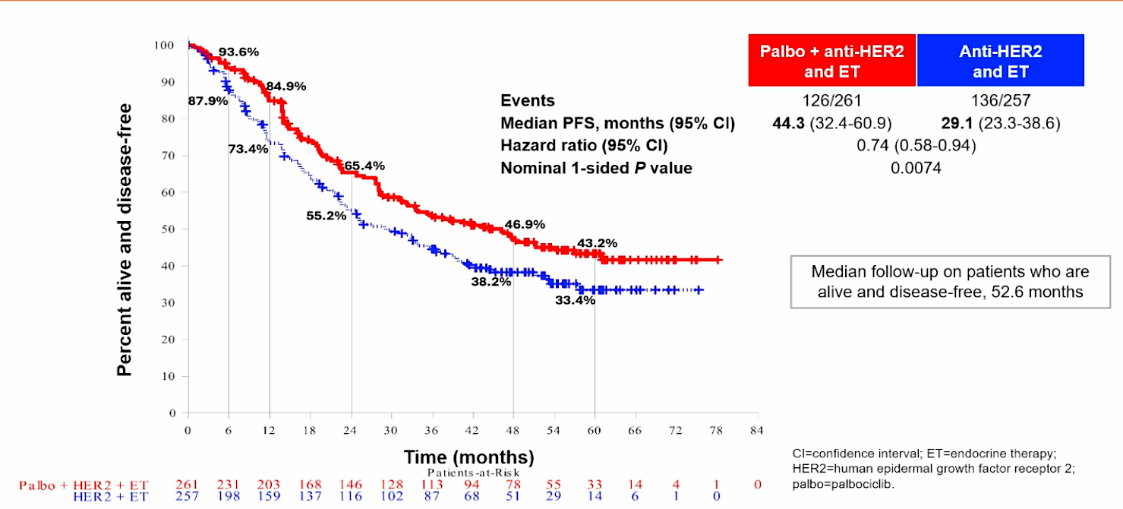
1L HR+/HER2+ mBC: PATINA Trial
PFS
Claudine Isaacs, MD, FRCPC
Discussant. Abstract LBA1008
Metzger, O, et al. SABCS 2024; GS2-12

Slide 81
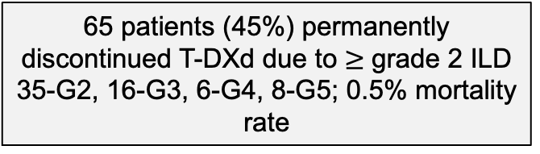
T-DXd Rechallenge After ILD
65 patients (45%) permanently discontinued T-DXd due to $≥$grade 2 ILD
35-G2, 16-G3, 6-G4, 8-G5; 0.5% mortality rate
1,476 patients treated with T-DXd at 5 institutions from 2017-2024
Patients rechallenged outside of guidelines
Remained on treatment for a median of 91 days
3 patients (16%) developed recurrent ILD (1-G2, 1-G3, 1-G4)
143 patients (9.7%) developed any grade ILD
19 patients with grade 2 ILD were rechallenged
59 patients with G1 ILD eligible for rechallenge
6 patients not rechallenged due to disease progression at time of ILD diagnosis
8 patients not rechallenged at the provider’s discretion due to ILD findings
1 patient not rechallenged due to intolerable side effects
44 patients (75%) with G1 ILD were rechallenged
26 patients with G1 ILD were rechallenged after CT improvement of ILD
18 patients with grade 1 ILD were rechallenged before CT findings of ILD improved
12 patients (27%) developed recurrent ILD (8-G1, 2-G2, 2-G3)
3 patients were re-challenged a 2nd time without recurrent ILD
Hope S. Rugo, M.D.
*G = grade
Abstract 1015
Notes:
of the 16 patients with G2 ILD rechallenged received intervening therapy, rechallenged 238 and 554 days later
7 patients with recurrent ILD from 26 RC after CT improvement: (5-G1, 1-G2, 1-G3)
5 patients with recurrent ILD from 18 RC BEFORE CT improvement (4-G1, 1-G2)
All 3 patients RC a 2nd time, were RC within guidelines after CT Improvement

Slide 82
Conclusion
Rechallenge with T-DXd after grade 1 ILD was safe; patients in a diverse real-world population had ongoing clinical benefit from T-DXd.
High rates of rechallenge after grade 1 ILD were safe with long duration of clinical benefit
Treatment with steroids resulted in faster radiographic improvement of ILD
Among patients rechallenged after grade 1 ILD, rates of recurrent ILD were low, with mostly grade 1 events and no grade 5 events
A small number of patients with grade 2 ILD were rechallenged with a similar rate of recurrent ILD, but this data must be interpreted with caution
Hope S. Rugo, M.D.
Abstract 1015

Slide 83
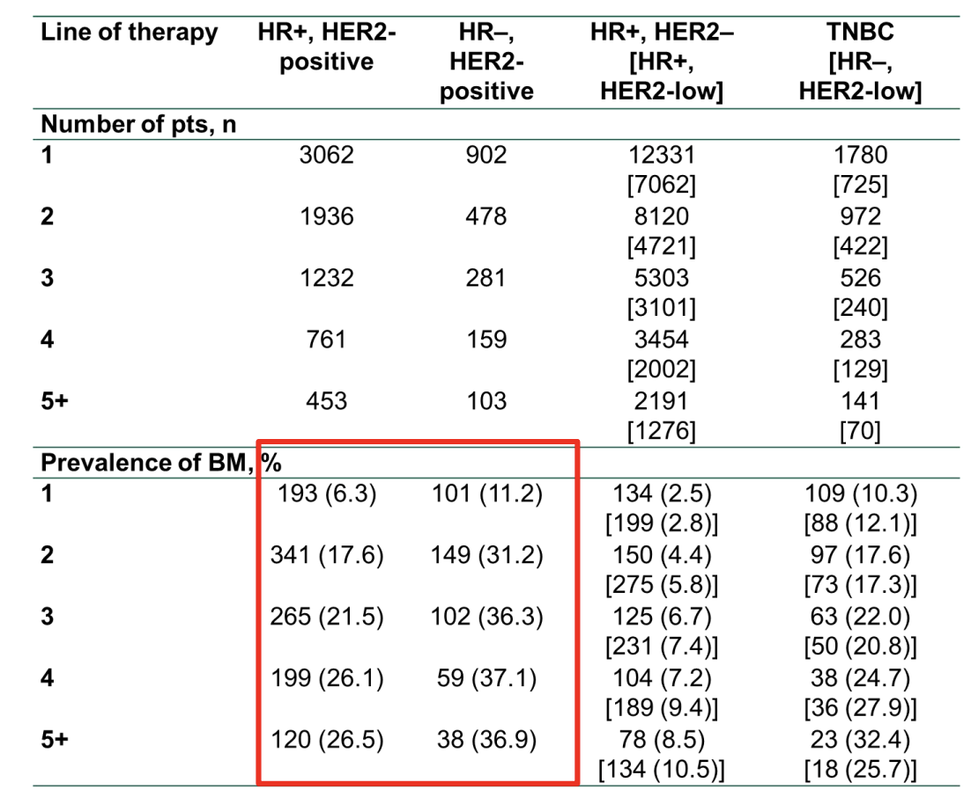
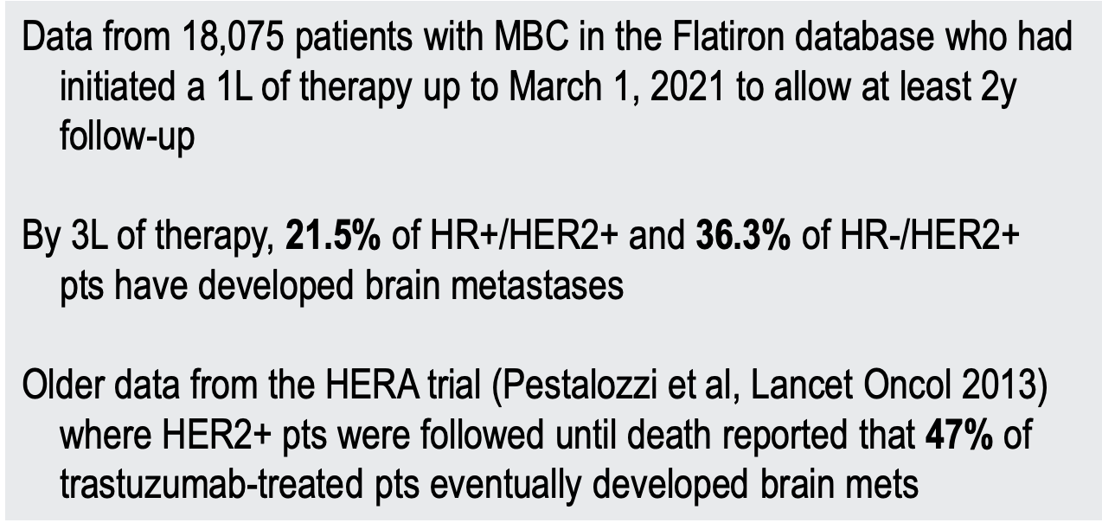
Incidence of BM in HER2+ MBC: Real-World Data
From US Flatiron Database
Sammons SL et al. 2023 SABCS Annual Meeting. Abstract PS11-01.

Slide 84
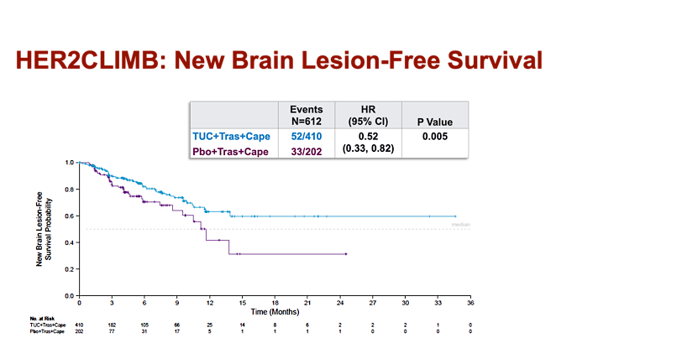
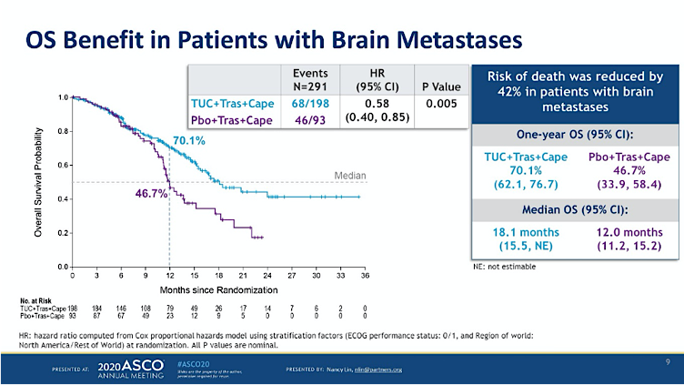
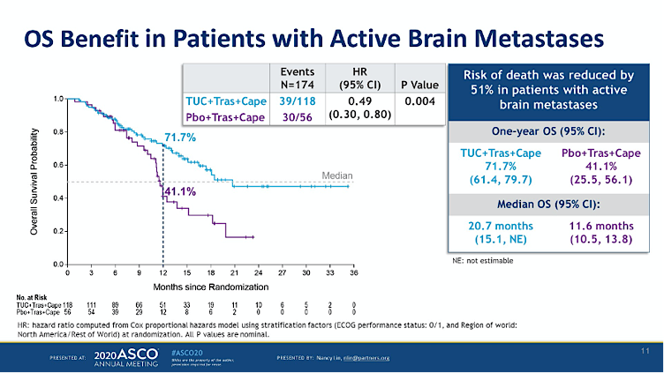
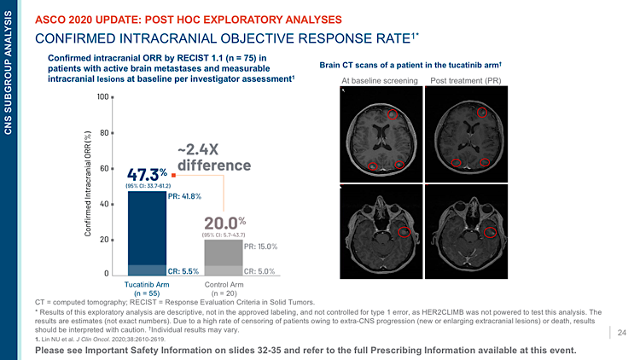
Lin NU et al. ASCO 2020;Abstract 1005

Slide 85
DESTINY-Breast12 study design
Phase 3b/4, multicenter, single-arm, two-cohort, open-label study of T-DXd in previously treated HER2+ mBC with and without brain metastases (BMs); the largest prospective study of T-DXd in patients with stable or active BMs
Patient population
Aged ≥18 years
Pathologically documented HER2+ advanced or metastatic BC with or without baseline brain metastases
Received ≤2 prior lines of therapy
in the metastatic setting
(tucatinib naïve)
Disease progression on prior
HER2-directed regimens
ECOG PS 0 or 1
No known or suspected leptomeningeal metastases
Baseline brain metastases
(N=263)*
Stable BMs (previously treated)
Active BMs (untreated or previously treated / progressing [not requiring immediate local therapy])
Primary endpoint:
PFS
Additional endpoints included:
CNS PFS
OS
ORR
CNS ORR
Safety and tolerability
T-DXd
5.4 mg/kg IV Q3W†
No baseline brain metastases (N=241)
Primary endpoint:
ORR
Additional endpoints included:
OS
Safety and tolerability
T-DXd
5.4 mg/kg IV Q3W†
Data reported for the full analysis set (all patients enrolled in the study who received at least one treatment dose) and safety analysis set (identical to full analysis set). No hypothesis testing or comparison of cohorts. Response and progression assessed by ICR per RECIST 1.1 in both cohorts. Patients were enrolled from Australia, Canada, Europe, Japan, and United States
*Concomitant use of ≤3 mg of dexamethasone daily or equivalent allowed for symptom control of BMs (baseline BMs cohort only); †until RECIST 1.1-defined disease progression outside the CNS
BC, breast cancer; CNS, central nervous system; ECOG PS, Eastern Cooperative Oncology Group performance status; HER2, human epidermal growth factor receptor 2; HER2+, HER2-positive; ICR, independent central review; IV, intravenous; mBC, metastatic breast cancer; ORR, objective response rate; OS, overall survival; PFS, progression-free survival; Q3W, every 3 weeks; RECIST 1.1, Response Evaluation Criteria in Solid Tumours version 1.1; T-DXd, trastuzumab deruxtecan
NCT04739761. Updated. July 19, 2024. Available from: https://www.clinicaltrials.gov/study/NCT04739761 (Accessed September 9, 2024)
Nancy U Lin, MD
Abstract LBA18

Slide 86
Baseline BMs: CNS ORR
100
Patients with measurable CNS disease at baseline (post-hoc analysis)
n=138
80
60
40
20
Best percentage change in target CNS lesion size from baseline
0
−20
−40
−60
−80
−100
 |  |  |  | Active BM subgroups
Measurable CNS disease at baseline | All patients (n=138) | Stable BMs (n=77) | Active BMs (n=61) | Untreated (n=23) Post-hoc analysis | Previously treated / progressing (n=38) Post-hoc analysis
Confirmed CNS ORR, % (95% CI) | 71.7 (64.2, 79.3) | 79.2 (70.2, 88.3) | 62.3 (50.1, 74.5) | 82.6 (67.1, 98.1) | 50.0 (34.1, 65.9)
T-DXd showed substantial CNS responses in the overall BMs population, including patients with stable and active BMs
Dashed line indicates a 30% decrease in target tumor size (PR)
*Imputed values: a value of +20% was imputed if best percentage change could not be calculated because of missing data if: a patient had a new lesion or progression of non-target lesions or target lesions, or had withdrawn because of PD and had no evaluable target lesion data before or at PD
BM, brain metastasis; CI, confidence interval; CNS, central nervous system; ORR, objective response rate; PD, progressive disease; PR, partial response; T-DXd, trastuzumab deruxtecan
Nancy U Lin, MD
Abstract LBA18

Slide 87
OS in patients with and without baseline BMs
Baseline BMs (KM analysis)
No baseline BMs (KM analysis)
1.0
No. patients / no. events: 263 / 43
Data maturity: 16.3%
1.0
No. patients / no. events: 241 / 41
Data maturity: 17.0%
0.9
0.9
0.8
0.8
0.7
0.7
0.6
0.6
Probability of OS
12-month OS:
90.3%
(95% CI 85.9, 93.4)
Probability of OS
12-month OS:
90.6%
(95% CI 86.0, 93.8)
0.5
0.5
0.4
0.4
0.3
0.3
0.2
0.2
0.1
0.1
0.0
0
1
2
3
4
5
6
7
8
9
10
11
12
13
14
15
16
17
18
19
20
21
22
23
24
25
26
27
28
29
30
0.0
0
1
2
3
4
5
6
7
8
9
10
11
12
13
14
15
16
17
18
19
20
21
22
23
24
25
26
27
28
29
30
Months
Months
At risk
263
261
257
252
247
242
238
236
231
225
209
191
177
165
149
137
122
100
84
75
65
52
38
31
22
15
8
3
2
2
1
At risk
241
239
237
231
229
224
223
220
217
214
203
194
179
165
154
133
123
107
91
75
67
51
38
25
16
10
6
6
2
0
T-DXd showed consistent 12-month OS in patients with and without BMs
Median follow-up duration was 15.4 months in patients with BMs and 16.1 months in patients without BMs
BM, brain metastasis; CI, confidence interval; KM, Kaplan-Meier; no., number of; OS, overall survival; T-DXd, trastuzumab deruxtecan
Nancy U Lin, MD
Abstract LBA18

Slide 88
T-DXd Followed by THP Before Surgery Showed Statistically Significant and Clinically Meaningful Improvement in Pathologic Complete Response in Patients with High-Risk HER2-Positive Early-Stage Breast Cancer in DESTINY-Breast11 Phase III Trial
Press Release: May 7, 2025
“Positive high-level results from the DESTINY-Breast11 Phase III trial showed trastuzumab deruxtecan (T-DXd) followed by paclitaxel, trastuzumab and pertuzumab (THP) demonstrated a statistically significant and clinically meaningful improvement in pathologic complete response (pCR) rate versus standard of care (dose-dense doxorubicin and cyclophosphamide followed by THP [ddAC-THP]) when used in the neoadjuvant setting (before surgery) in patients with high-risk, locally advanced HER2-positive early-stage breast cancer.
The secondary endpoint of event-free survival (EFS) was not mature at the time of analysis; however, EFS data showed an early positive trend favouring T-DXd followed by THP compared to standard of care. The trial will continue to follow EFS.
Data from DESTINY-Breast11 will be presented at an upcoming medical meeting and shared with regulatory authorities.”
https://www.astrazeneca.com/media-centre/press-releases/2025/enhertu-improved-pcr-in-early-stage-breast-cancer.html

Slide 89
Faculty Discussion Questions
What is the optimal first-line therapy, including maintenance, for patients with HER2-positive, ER-negative mBC? What about for
HER2-positive, ER-positive disease?
In which situations will you rechallenge with T-DXd for patients who have developed ILD on the drug?
What is your preferred second-line therapy for patients with HER2-positive disease who experience progression on THP with brain metastases?

Slide 90
Agenda
Introduction: View from Outer Space
Module 1: HR-Positive Breast Cancer
Module 2: HER2-Positive Breast Cancer
Module 3: Triple-Negative Breast Cancer

Slide 91
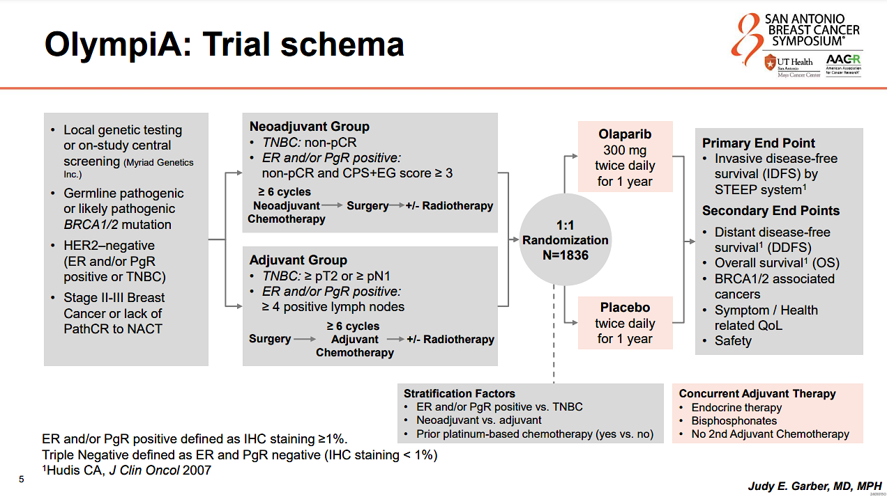
Garber JE et al. SABCS 2024; Abstract GS1-09

Slide 92
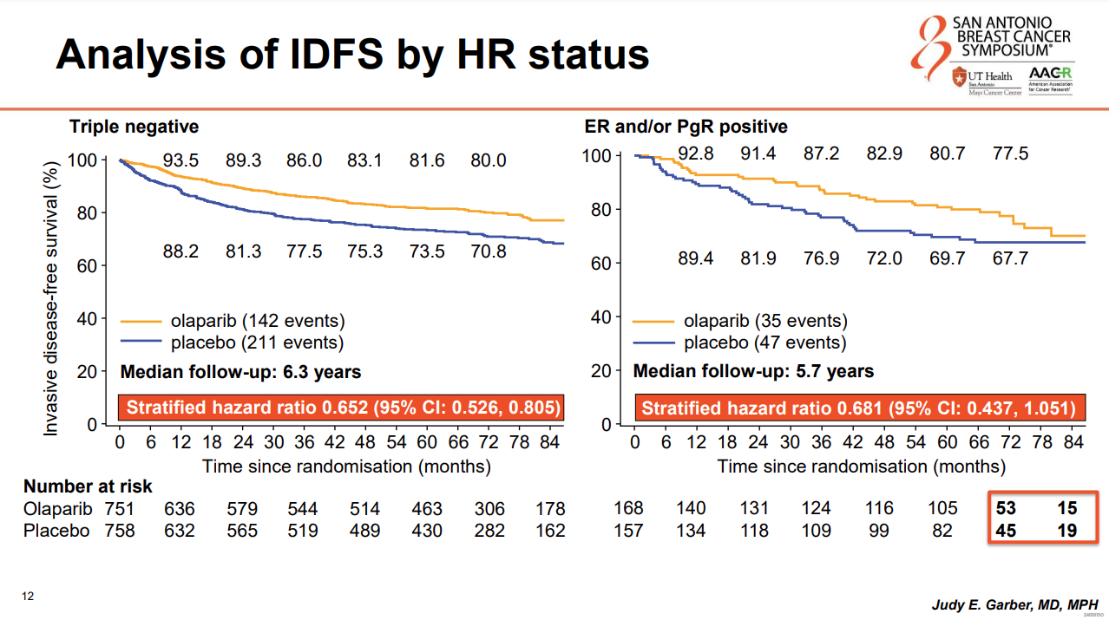
Garber JE et al. SABCS 2024; Abstract GS1-09

Slide 93
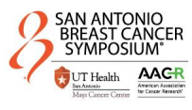
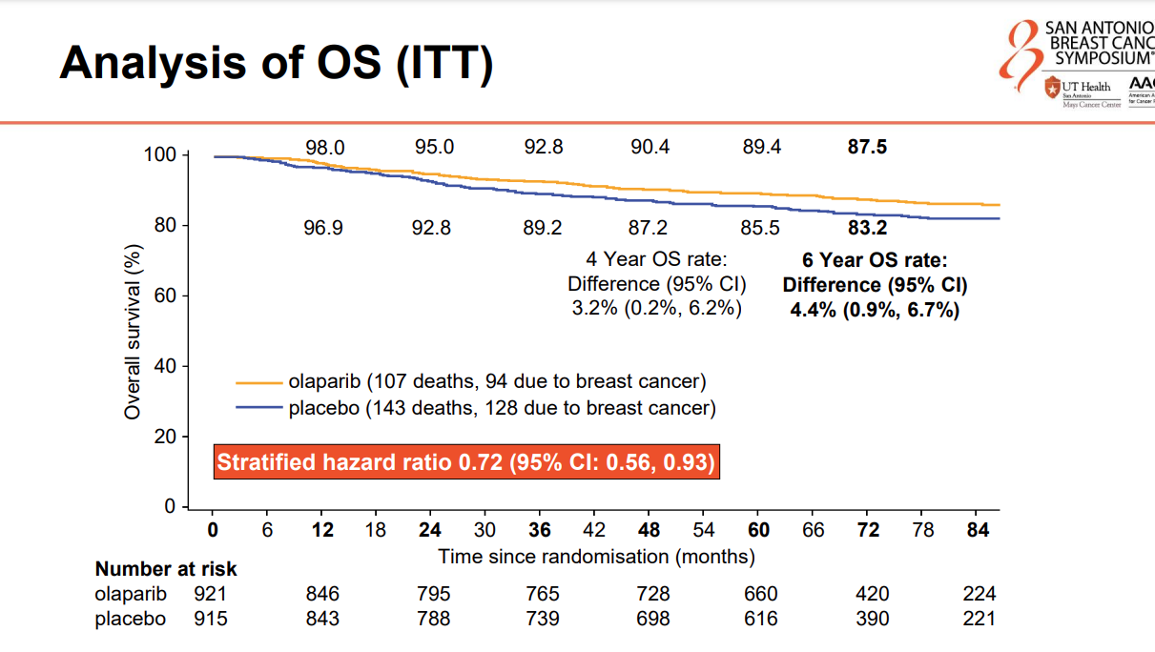
Garber JE et al. SABCS 2024; Abstract GS1-09

Slide 94
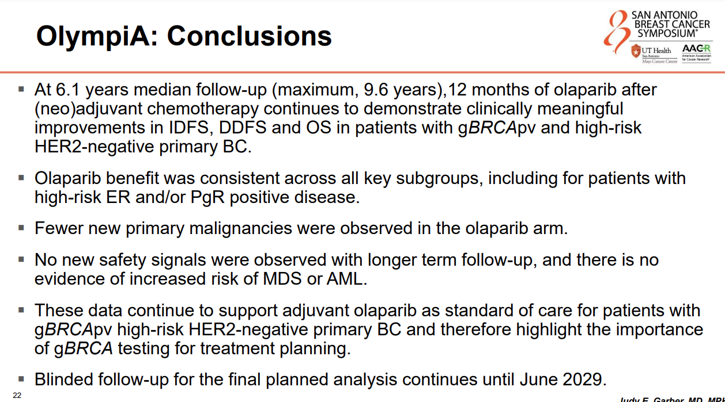
Garber JE et al. SABCS 2024; Abstract GS1-09

Slide 95
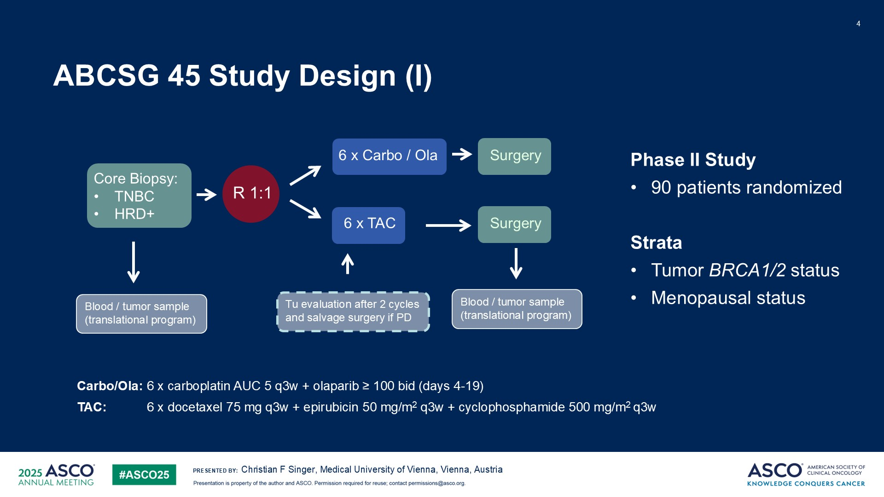
ABCSG 45 Study Design (I)
Abstract 510

Slide 96
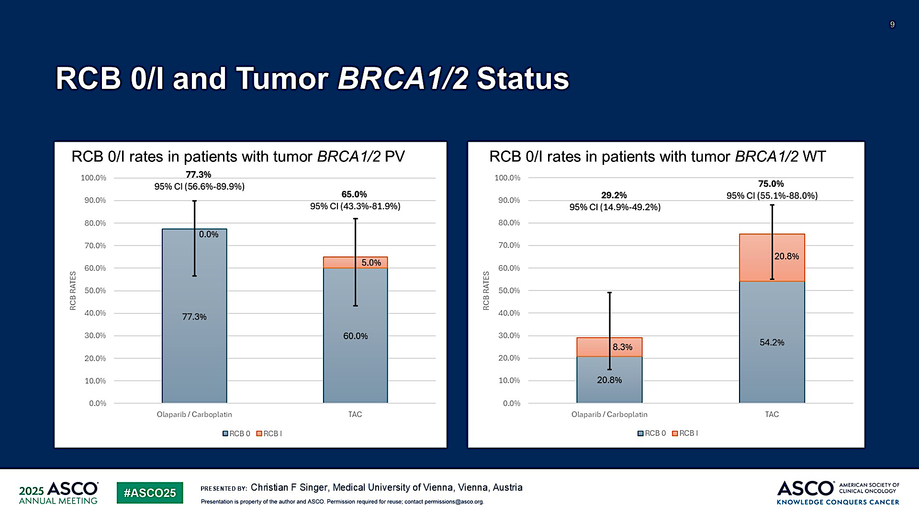
RCB 0/I and Tumor BRCA1/2 Status
Multi-agent chemo needed in the WT group
Abstract 510

Slide 97
TROP2-directed ADCs
 | Sacituzumab govitecan (IMMU-132) | Datopotamab deruxtecan (DS-1062a) | Sacituzumab tirumotecan (MK-2870)
Antibody | hRS7 Humanized IgG1 mAb | MAAP-9001a Humanized IgG1 mAb | hRS7 Humanized IgG1 mAb
Payload | SN38 (DNA Topoisomerase I inhibitor) | DXd (DNA Topoisomerase I inhibitor) | KL610023 (DNA Topoisomerase I inhibitor)
Linker cleavage | Enzymatic and pH-dependent | Enzymatic | Enzymatic and pH-dependent
Bystander effect | Yes | Yes | Yes
DAR | 7.6 | 4 | 7.4
Half-life | 11-14h | ∼5 days | 57h
Dosing | D1, D8 of Q3W schedule | Q3W | Q2W
Sands J et al. ASCO 2018; Okajima D et al. ASCO 2018; Bardia A et al. ESMO Breast Cancer 2021; Cheng Y et al. Front Oncol 2022.

Slide 98
ASCENT-04/KEYNOTE-D19 Study Design
Previously untreated, locally advanced unresectable, or metastatic TNBCª:
  PD-L1-positive (CPS ≥ 10 by the 22C3 assay^{b})
  ≥ 6 months since treatment in curative setting (prior anti-PD-[L]1 use allowed)
  N = 443
SG + pembro^{d}
(SG 10 mg/kg IV, days 1 and 8 of 21-day cycles; pembro 200 mg, day 1 of 21-day cycles)
n = 221
End points
Primary
PFS by BICR^{e}
Secondary
OS
ORR, DOR by BICR^{e}
Safety
QoL
All treatment, including SG or chemo, was continued until BICR-verified disease progression or unacceptable toxicity
R
1:1
Chemo* + pembro^{d}
(paclitaxel 90 mg/m² OR nab-paclitaxel
100 mg/m² on days 1, 8, & 15 of 28-day cycles, OR gemcitabine 1000 mg/m² + carboplatin AUC 2 on days 1 & 8 of 21-day cycles; pembro 200 mg on day 1 of 21-day cycles)
n = 222
Stratification factors:
  De novo mTNBC^{c} vs recurrent within 6 to 12 months from completion of treatment in curative setting vs recurrent
  > 12 months from completion of treatment in curative setting
  US/Canada/Western Europe vs the rest of the world
  Prior exposure to anti-PD-(L)1 (yes vs no)
*Eligible patients who experienced BICR-verified disease progression were
offered to cross-over to
receive 2L SG monotherapy
  Median follow-up was 14.0 months (range, 0.1-28.6)
  95 patients (43%) in the SG + pembro group and 52 patients (23%) in the chemo + pembro group continued to receive study treatment
ClinicalTrials.gov identifier: NCT05382286.
ªTNBC status determined according to standard American Society of Clinical Oncology-College of American Pathologists criteria. ^{b}Dako, Agilent Technologies. ^{c}Up to 35% de novo mTNBC. ^{d}Pembro was administered for a maximum of 35 cycles. ^{e}Per RECIST v1.1.
AUC, area under the curve; BICR, blinded independent central review; chemo, chemotherapy; CPS, combined positive score; DOR, duration of response; IV, intravenously; ORR, objective response rate; OS, overall survival; PD-L1, programmed cell death ligand 1; pembro, pembrolizumab; PFS, progression-free survival; QoL, quality of life; R, randomized; RECIST v1.1; Response Evaluation Criteria in Solid Tumors, version 1.1; SG, sacituzumab govitecan; TNBC, triple-negative breast cancer; TTR, time-to-response.
Tolaney SM et al. ASCO 2025;Abstract LBA109

Slide 99
Progression-Free Survival by BICR
 | SG + Pembro (n = 221) | Chemo + Pembro (n = 222)
Number of PFS events | 109 | 140
Median PFS, mo (95% CI) | 11.2 (9.3-16.7) | 7.8 (7.3-9.3)
Stratified HR (95% CI) | 0.65 (0.51-0.84)
P-valueª | < 0.001
6-month PFS rate, % (95% CI) | 72 (65-77) | 63 (56-69)
12-month PFS rate, % (95% CI) | 48 (41-56) | 33 (26-40)
100
90
80
70
60
50
40
30
20
10
0
6 mo
12 mo
Progression-Free Survival Probability (%)
0 | 2 | 4 | 6 | 8 | 10 | 12 | 14 | 16 | 18 | 20 | 22 | 24 | 26
Time (months)
No. of Patients Still at Risk (Events)
SG + Pembro
Chemo + Pembro
221 (0) | 202 (11) | 174 (33) | 142 (59) | 105 (75) | 78 (89) | 58 (96) | 42 (98) | 34 (99) | 22 (103) | 11 (106) | 6 (109) | 2 (109) | 0 (109)
222 (0) | 191 (21) | 159 (48) | 123 (76) | 88 (102) | 59 (120) | 40 (128) | 29 (134) | 21 (135) | 13 (137) | 7 (138) | 4 (138) | 1 (139) | 0 (140)
SG + pembro demonstrated statistically significant and clinically meaningful improvement in PFS vs chemo + pembro by BICR analysis, with a 35% reduction in risk of disease progression or death
Data cutoff date: March 3, 2025.
ªTwo-sided P-value from stratified log-rank test.
BICR, blinded independent central review; chemo, chemotherapy; HR, hazard ratio; PFS, progression-free survival; pembro, pembrolizumab; SG, sacituzumab govitecan.
Tolaney SM et al. ASCO 2025;Abstract LBA109

Slide 100
Conclusions
ASCENT-04/KEYNOTE-D19 is the first randomized, phase 3 study to evaluate the efficacy and safety of an ADC/checkpoint inhibitor combination for first-line treatment of patients with PD-L1+ª mTNBC
SG + pembro led to a statistically significant and clinically meaningful improvement in PFS vs chemo + pembro (median 11.2 vs 7.8 months; HR, 0.65; 95% CI, 0.51-0.84; P < 0.001)
  PFS benefit was observed across prespecified subgroups
OS data are immature, but an early trend in improvement was observed
ORR was higher (including an increased complete response rate), and responses were more durable with SG + pembro vs chemo + pembro
The safety profile of SG + pembro was consistent with the established profiles of either agent; no additive toxicity was observed
Results from ASCENT-04/KEYNOTE-D19 support the use of SG + pembro as a potential new standard of care for patients with previously untreated, PD-L1+, locally advanced unresectable or metastatic TNBC
Data cutoff date: March 3, 2025
ªCPS ≥ 10 per IHC 22C3 assay (Dako, Agilent Technologies).
ADC, antibody drug conjugate; chemo, chemotherapy; CPS, combined positive score; DOR, duration of response; HR, hazard ratio; IHC, immunohistochemistry; mTNBC; metastatic triple-negative breast cancer; ORR, objective response rate; OS, overall survival; PD-L1, programmed cell death ligand 1; pembro, pembrolizumab; PFS, progression-free survival; SG, sacituzumab govitecan; TNBC, triple-negative breast cancer.
Tolaney SM et al. ASCO 2025;Abstract LBA109

Slide 101
May 23, 2025
ASCENT-03: Sacituzumab Govitecan Demonstrates Highly Statistically Significant & Clinically Meaningful Improvement in Progression Free Survival in Patients With First-line Metastatic Triple-Negative Breast Cancer Who Are Not Candidates for Checkpoint Inhibitors
The study met its primary endpoint, demonstrating a highly statistically significant and clinically meaningful improvement in progression-free survival (PFS) compared to chemotherapy in patients with first-line mTNBC who are not candidates for PD-1/PD-L1 inhibitors, meaning they are PD-L1 negative or are ineligible to receive immunotherapy.

Slide 102
TROPION-Breast02 + TROPION-Breast05 Study Design
TROPION-Breast02^{1,2}
TROPION-Breast05³
Untreated, inoperable/locally advanced or metastatic TNBC
PD-L1− (CPS <10) OR PD-L1+ (CPS ≥10) if treated with an anti-PD-(L)1 agent for eBC or if they cannot be treated with an anti-PD-(L)1 agent due to a comorbidity, or if no regulatory access to an anti-PD-(L)1 agent
No minimum DFI since completion of Tx in curative setting (DFI ≤12 months capped at 20%)
History of ILD/pneumonitis and clinically significant corneal disease excluded
PD-L1+ (CPS ≥10) untreated, inoperable/locally advanced or metastatic TNBC
DFI ≥6 months since Tx in curative setting (DFI 6–12 months capped at 20%)
Prior PD-(L)1 use allowed in this setting
History of ILD/pneumonitis and clinically significant corneal disease excluded
Patient Population
Patient Population
Dato-DXd + durvalumab
Dato-DXd monotherapy
R
1:1
R
1:1
Study Design
Dato-DXd monotherapy
Study Design
N~625
N=644
TPC chemo
(pac, nab-pac, capecitabine, carboplatin, eribulin)
TPC chemo + pembrolizumab
(gem + carbo; pac; nab-pac)
Stratification Factors
Geographic region
PD-L1 status
De novo vs prior DFI ≤12 months vs prior DFI >12 months
Stratification Factors
Geographic region
Prior PD-(L)1
De novo vs prior DFI 6–12 months vs prior DFI >12 months
Key Endpointsª
Key Endpointsª
Primary: PFS by BICR, OS
Secondary: ORR, DOR, PFS (investigator), safety, PROs
Primary: PFS by BICR
Secondary: OS, PFS (investigator), ORR, safety, PROs
ªSecondary endpoints not exhaustive.
1L, first line; BICR, blinded independent central review; carbo, carboplatin; chemo, chemotherapy; CPS, combined positive score; Dato-DXd, datopotamab deruxtecan; DFI, disease-free interval; eBC, early-stage breast cancer; gem, gemcitabine;
nab-pac, nab-paclitaxel; ORR, objective response rate; OS, overall survival; pac, paclitaxel; PD-1, programmed death protein 1; PD-L1, programmed death ligand 1; PD-L1−, programmed death ligand 1-negative; PD-L1+, programmed death ligand 1-positive; PFS, progression-free survival; PROs, patient-reported outcomes; R, randomization; TNBC, metastatic triple-negative breast cancer; TPC, treatment of physician’s choice; Tx, therapy.
1. Dent RA, et al. Future Oncol. 2023;19(35):2349–2359; 2. https://clinicaltrials.gov/study/NCT05374512; 3. Schmid P, et al. Ther Adv Med Oncol. 2025;17:17588359251327992.
Notes:
Data sources:
TB-02: Dent 2023 for all content except number of randomized patients (clinicaltrials.gov)
TB-05: Schmid (all content)

Slide 103

NCCN and ESMO Guidelines for 1L
Treatment of mTNBC
Identify Biomarkers/Subtype
PD-L1–
PD-L1+
USA and EU
USA
EU
PD-L1− Germline BRCA wt
Germline BRCA mut
De novo or recurrence >6–12 mo post (neo)adj ICI
Recurrence ≤6–12 mo post (neo)adj ICI
Germline
BRCA wt
Germline BRCA mut
First Line
Chemo
(+ bevacizumab in EU)
PARPi
Chemo
Pembro + chemo
Atezo + chemo
SG
Chemo
Chemo
PARPi
Sacituzumab govitecan
SG + Pembro
(ASCENT-04)
Future Positioning
Second Line
SG monotherapy (ASCENT-03)
Chemo
Dato-DXd monotherapy (TROPION-Breast02)
Dato-DXd + Durva (TROPION-Breast05)
T-DXd if HER2-low
PARPi
1L, first line; atezo, atezolizumab; chemo, chemotherapy; Dato-DXd, datopotamab deruxtecan; durva, durvalumab; ESMO, European Society for Medical Oncology;
EU, European Union; ICI, immune checkpoint inhibitor; mo, months; mTNBC, metastatic triple-negative breast cancer; mut, mutation; NCCN, National Comprehensive Cancer Network; (neo)adj, neoadjuvant or adjuvant; PARPi, poly (ADP-ribose) polymerase inhibitor; PD-L1−/+, programmed cell death ligand 1-negative/positive; pembro, pembrolizumab; SG, sacituzumab govitecan; wt, wild-type.
Notes:
Sources:
NCCN Guidelines
https://www.ema.europa.eu/en/documents/product-information/lynp
https://www.accessdata.fda.gov/drugsatfda_docs/label/2018/211651s000lbl.pdf
https://www.ema.europa.eu/en/documents/product-information/talzenna-epar-product-information_en.pdf
https://www.accessdata.fda.gov/drugsatfda_docs/label/2020/208558s014lbl.pdf
Clinicaltrials.gov (for future positioning information)

Slide 104
Sacituzumab Tirumotecan (sac-TMT)

Slide 105
OptiTROP-Breast05: Phase II 1st Line Sac-TMT
N=41
Disease-free interval, n (%)
De novo metastasis | 12 (29.3)
6-12 months | 8 (19.5)
≥12 months | 21 (51.2)
PD-L1 expression,^{b} n (%)
CPS <10 | 32 (78.0)
CPS ≥10 | 9 (22.0)
Yin Y et al, ASCO 2025;Abstract 1019

Slide 106
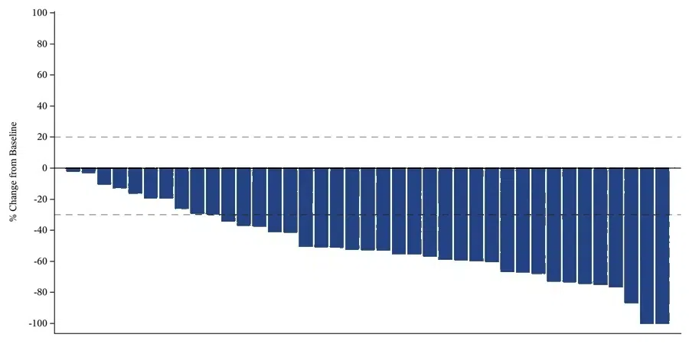
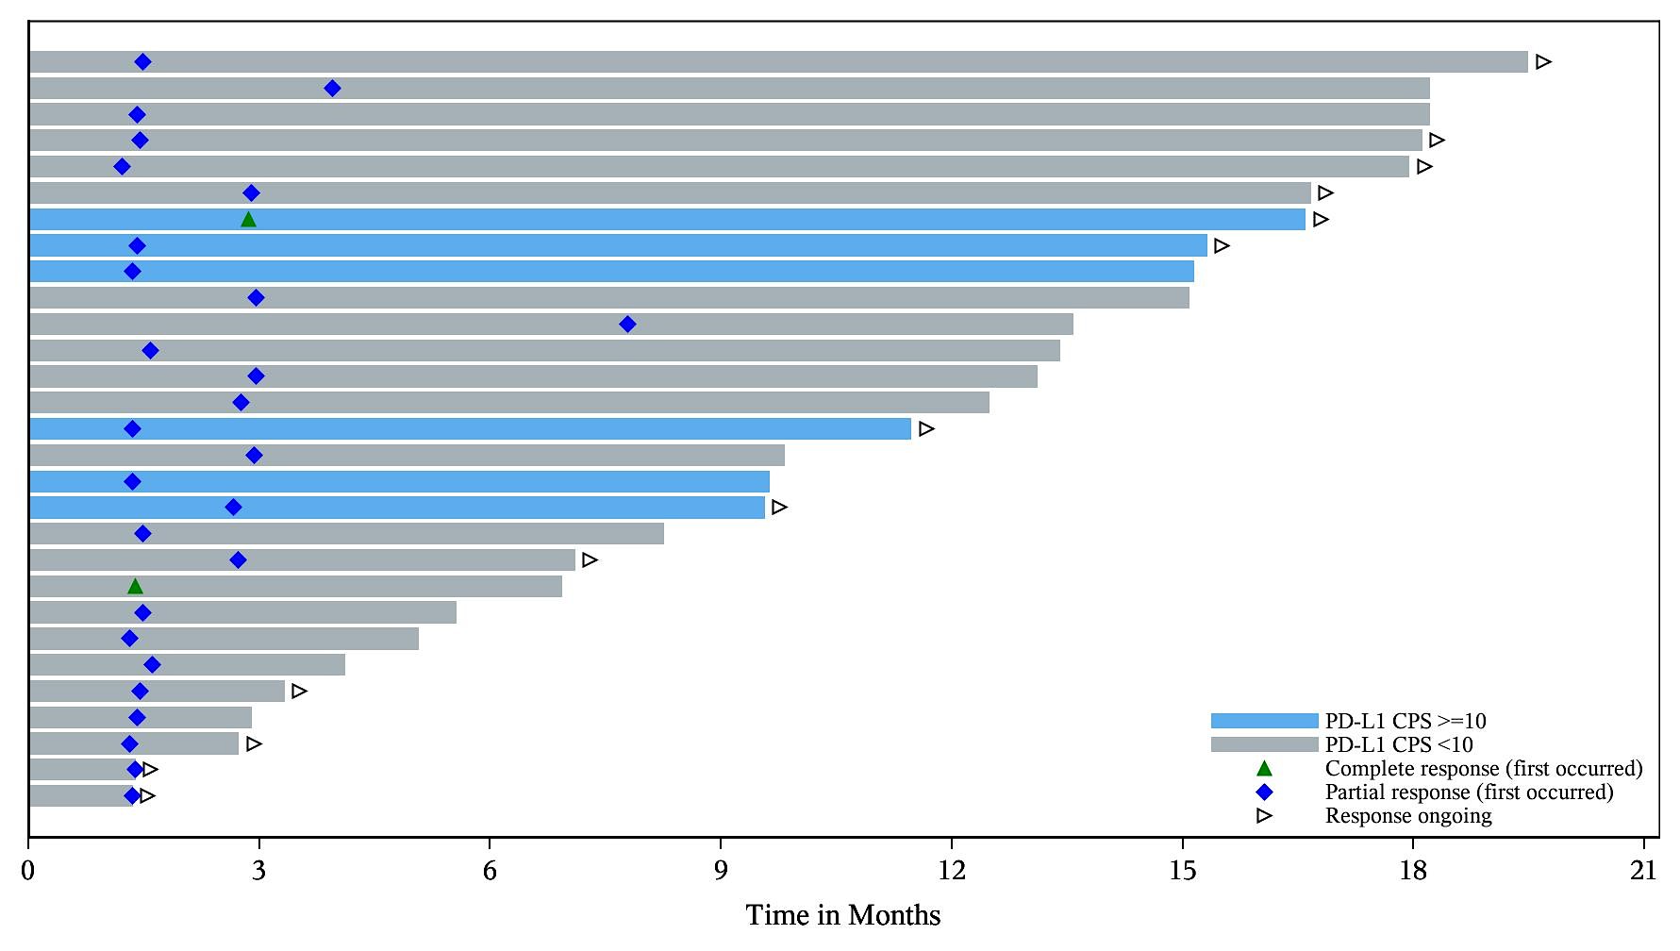
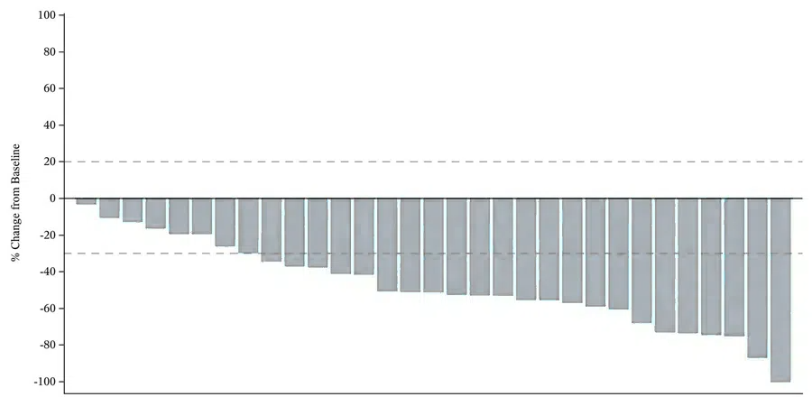
OptiTROP-Breast05: Phase II 1st Line Sac-TMT
N=41
Median DOR was 12.2 mo (range: 1.4+-18.0+) and 12-month DOR rate was 50.6% in all patients.
All patients ORR: 70.7%
PD-L1 CPS <10 ORR: 71.9%
Yin Y et al, ASCO 2025;Abstract 1019
Median follow-up was 18.6 months.

Slide 107

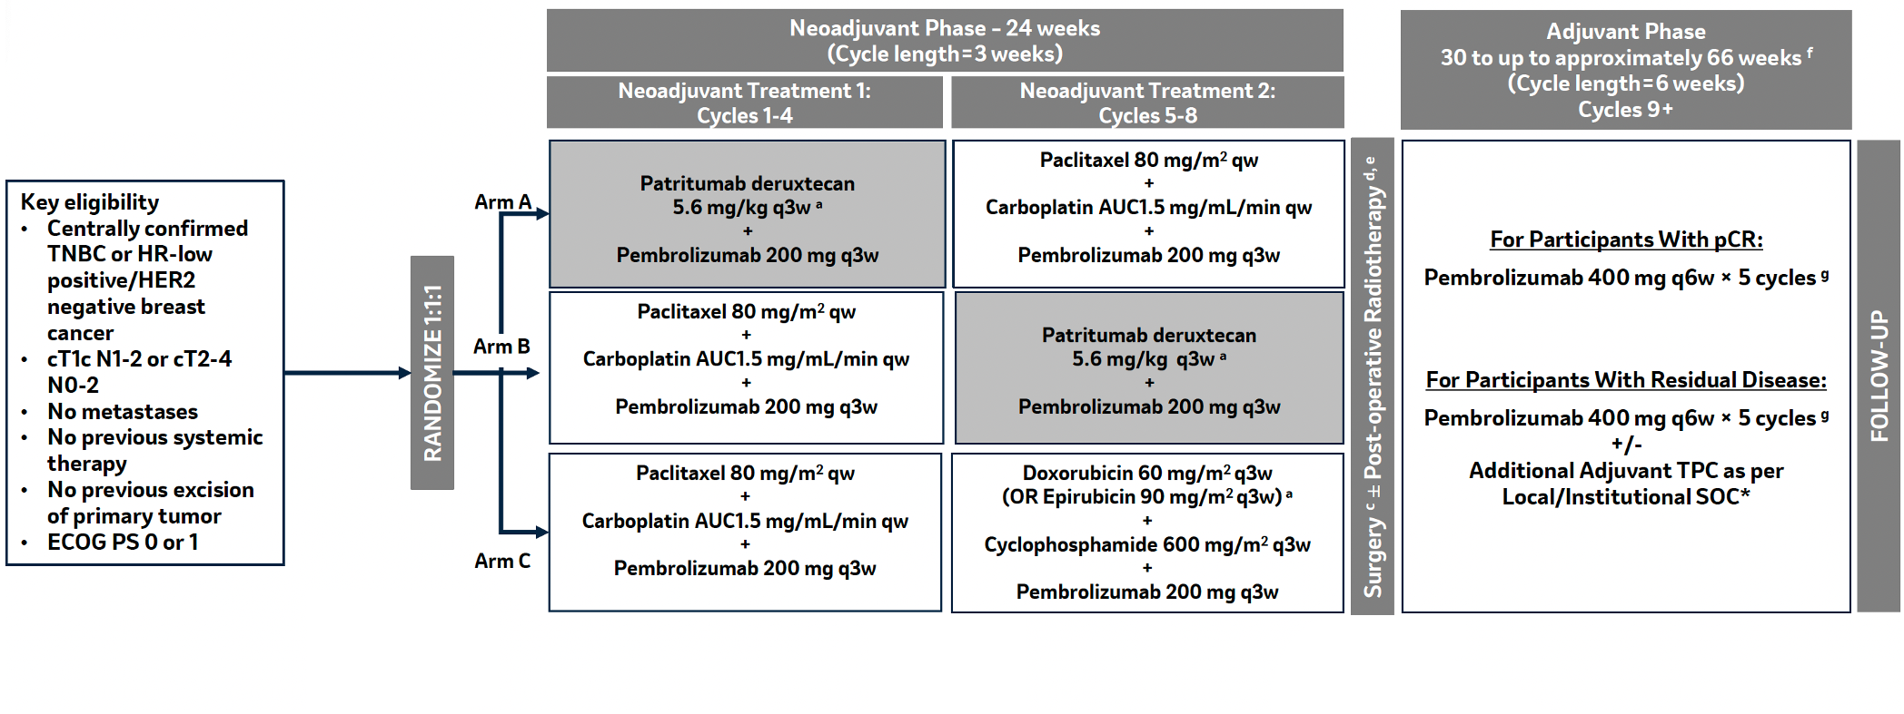

HERTHENA-Breast03 (NCT06797635): Preoperative HER3-DXd in sequence in TNBC
PART 2: MAIN STUDY
N ~ 300
O’Shaughnessy J et al, ASCO 2025;Abstract TPS629

Slide 108
Adjuvant Olaparib Indication
As adjuvant therapy for adult patients with deleterious or suspected deleterious germline BRCA-mutant, HER2-negative high-risk localized breast cancer who have received neoadjuvant or adjuvant chemotherapy

Slide 109
Faculty Discussion Questions
For which patients with localized disease are you using adjuvant olaparib, and how does this correlate with the current FDA indication?
Reimbursement and regulatory issues aside, what is the optimal first-line therapy for patients with PD-L1-positive and PD-L1-negative mTNBC? How does prior treatment in the neoadjuvant and adjuvant settings affect this?

Slide 110
Selection and Sequencing of Therapy for
Metastatic Triple-Negative Breast Cancer
A CME/MOC-Accredited Live Webinar
Thursday, August 28, 2025
5:00 PM – 6:00 PM ET
Faculty
Ana C Garrido-Castro, MD
Professor Peter Schmid, FRCP, MD, PhD
Moderator
Neil Love, MD

Slide 111
Thank you for joining us!
Please take a moment to complete the survey currently up on Zoom. Your feedback is very important to us.
The survey will remain open for
5 minutes after the meeting ends.
Information on how to obtain CME, ABIM MOC and ABS credit is provided in the Zoom chat room.
Attendees will also receive an email in 1 to 3 business days with these instructions.

