Slide 1
Selection and Sequencing of Therapy for
Metastatic Triple-Negative Breast Cancer
A CME/MOC-Accredited Live Webinar
Thursday, August 28, 2025
5:00 PM – 6:00 PM ET
Faculty
Ana C Garrido-Castro, MD
Professor Peter Schmid, FRCP, MD, PhD
Moderator
Neil Love, MD

Slide 2
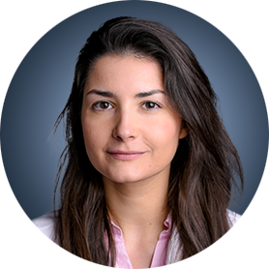
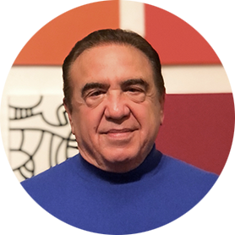

Faculty
Ana C Garrido-Castro, MD
Assistant Professor of Medicine
Harvard Medical School
Director, Triple-Negative Breast Cancer Research
Susan F Smith Center for Women's Cancers
Department of Medical Oncology
Dana-Farber Cancer Institute
Boston, Massachusetts
MODERATOR
Neil Love, MD
Research To Practice
Miami, Florida
Professor Peter Schmid, FRCP, MD, PhD
Lead, Centre of Experimental Cancer Medicine
Barts Cancer Institute
London, United Kingdom

Slide 3
Commercial Support
This activity is supported by an educational grant from Gilead Sciences Inc.

Slide 4
Dr Love — Disclosures
Dr Love is president and CEO of Research To Practice. Research To Practice receives funds in the form of educational grants to develop CME activities from the following companies: Aadi Bioscience, AbbVie Inc, ADC Therapeutics, Alexion Pharmaceuticals, Amgen Inc, Array BioPharma Inc, a subsidiary of Pfizer Inc, Arvinas, Astellas, AstraZeneca Pharmaceuticals LP, Aveo Pharmaceuticals, Bayer HealthCare Pharmaceuticals, BeOne, Black Diamond Therapeutics Inc, Blueprint Medicines, Boehringer Ingelheim Pharmaceuticals Inc, Bristol Myers Squibb, Clovis Oncology, Coherus BioSciences, CTI BioPharma, a Sobi Company, Daiichi Sankyo Inc, Eisai Inc, Elevation Oncology Inc, Exact Sciences Corporation, Exelixis Inc, Genentech, a member of the Roche Group, Genmab US Inc, Geron Corporation, Gilead Sciences Inc, GSK, Hologic Inc, ImmunoGen Inc, Incyte Corporation, Ipsen Biopharmaceuticals Inc, Jazz Pharmaceuticals Inc, Johnson & Johnson, Karyopharm Therapeutics, Kite, A Gilead Company, Kura Oncology, Legend Biotech, Lilly, MEI Pharma Inc, Merck, Mersana Therapeutics Inc, Mirati Therapeutics Inc, Mural Oncology Inc, Natera Inc, Novartis, Novartis Pharmaceuticals Corporation on behalf of Advanced Accelerator Applications, Novocure Inc, Nuvalent, Pfizer Inc, Pharmacyclics LLC, an AbbVie Company, Puma Biotechnology Inc, Regeneron Pharmaceuticals Inc, Rigel Pharmaceuticals Inc, R-Pharm US, Sanofi, Seagen Inc, Servier Pharmaceuticals LLC, SpringWorks Therapeutics Inc, Stemline Therapeutics Inc, Syndax Pharmaceuticals, Taiho Oncology Inc, Takeda Pharmaceuticals USA Inc, TerSera Therapeutics LLC, and Tesaro, A GSK Company.

Slide 5
Research To Practice CME Planning Committee Members,
Staff and Reviewers
Planners, scientific staff and independent reviewers for Research To Practice have no relevant conflicts of interest to disclose.

Slide 6
Dr Garrido-Castro — Disclosures
Advisory Committees | AstraZeneca Pharmaceuticals LP, Daiichi Sankyo Inc, Gilead Sciences Inc, Novartis, Pfizer Inc
Consulting Agreements | AstraZeneca Pharmaceuticals LP, Daiichi Sankyo Inc, Gilead Sciences Inc, Novartis, Pfizer Inc, TD Cowen
Contracted Research | 4D Path, AstraZeneca Pharmaceuticals LP, Bicycle Therapeutics, Biovica International AB, Bristol Myers Squibb, Daiichi Sankyo Inc, Foundation Medicine, Gilead Sciences Inc, Merck, Novartis, Precede Biosciences, Zenith Epigenetics
Speaker/Honoraria | AstraZeneca Pharmaceuticals LP, Bicycle Therapeutics, Daiichi Sankyo Inc, Genentech, a member of the Roche Group, Gilead Sciences Inc
Travel/Other Support | AstraZeneca Pharmaceuticals LP, Daiichi Sankyo Inc, Genentech, a member of the Roche Group, Gilead Sciences Inc, Merck, Novartis, Pfizer Inc

Slide 7
Prof Schmid — Disclosures
Advisory Committees and Consulting Agreements | AstraZeneca Pharmaceuticals LP, Bayer HealthCare Pharmaceuticals, Boehringer Ingelheim Pharmaceuticals Inc, Celgene Corporation, Eisai Inc, Merck, Novartis, Pfizer Inc, Puma Biotechnology Inc, Roche Laboratories Inc
Contracted Research | Astellas, AstraZeneca Pharmaceuticals LP, Genentech, a member of the Roche Group, Medivation Inc, a Pfizer Company, Merck, Novartis, OncoGenex Pharmaceuticals Inc, Roche Laboratories Inc

Slide 8
This educational activity contains discussion of
non-FDA-approved uses of agents and regimens. Please refer to official prescribing information for each product for approved indications.

Slide 9
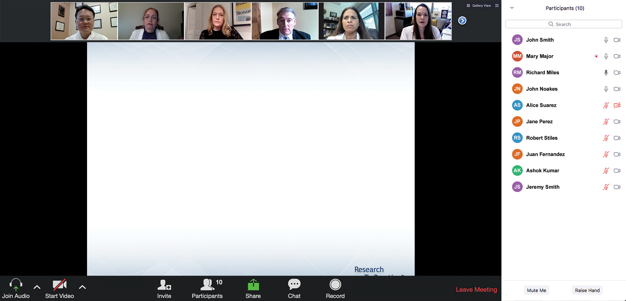

We Encourage Clinicians in Practice to Submit Questions
Feel free to submit questions now before the program begins and throughout the program.

Slide 10
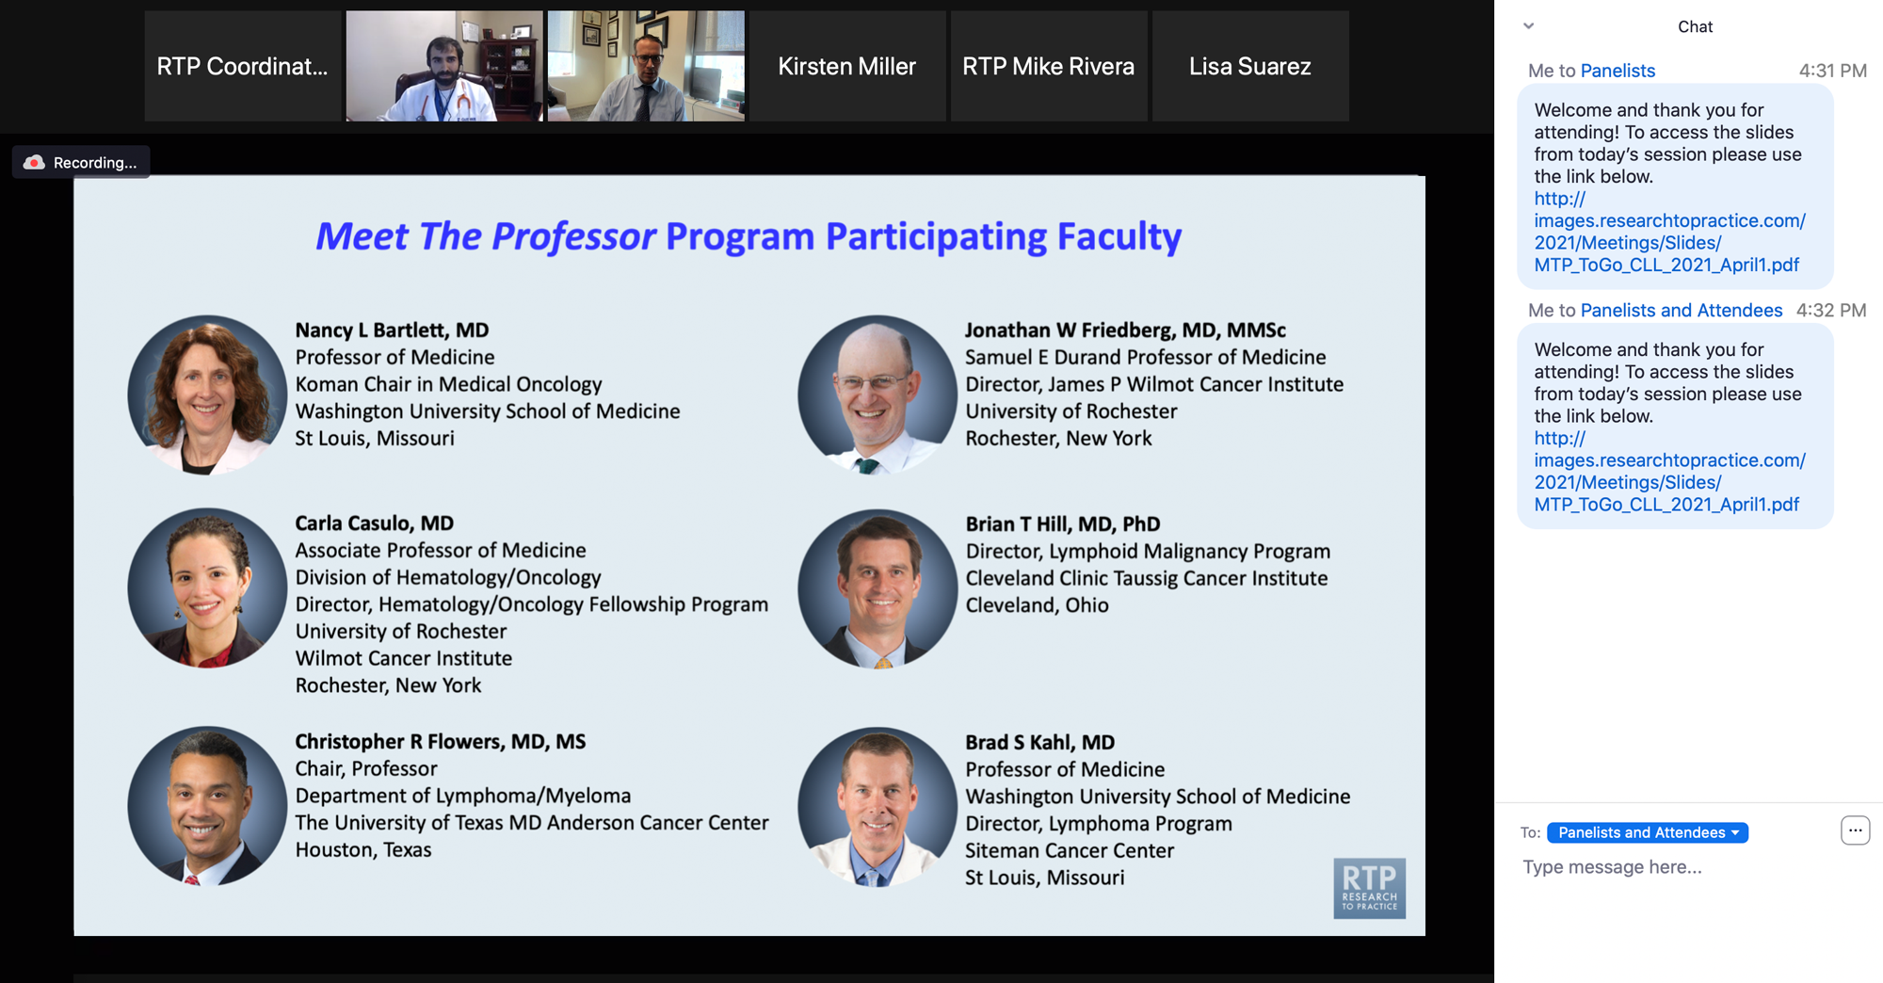
Familiarizing Yourself with the Zoom Interface
Expand chat submission box
Drag the white line above the submission box up to create
more space for your message.

Slide 11
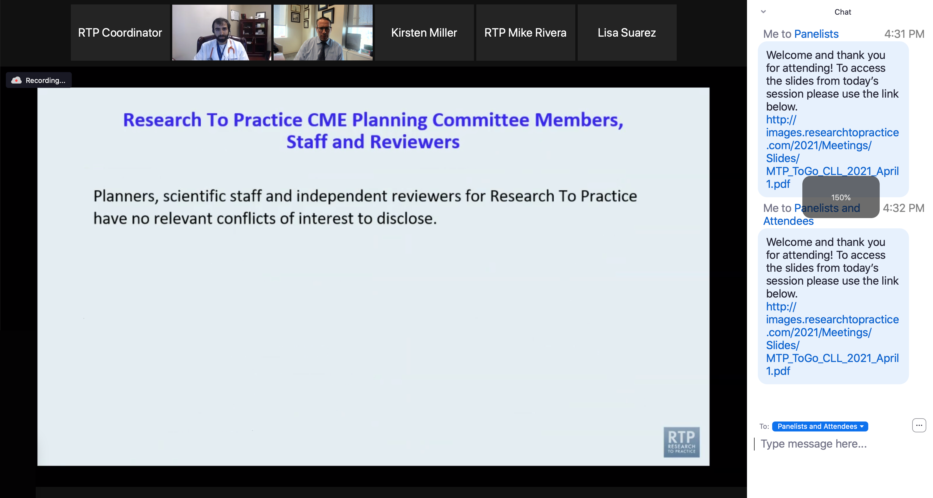
Familiarizing Yourself with the Zoom Interface
Increase chat font size
Press Command (for Mac) or Control (for PC) and the + symbol.
You may do this as many times as you need for readability.

Slide 12
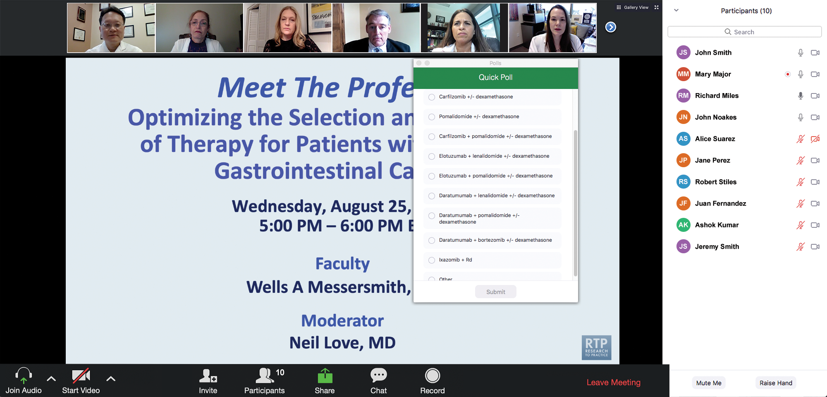
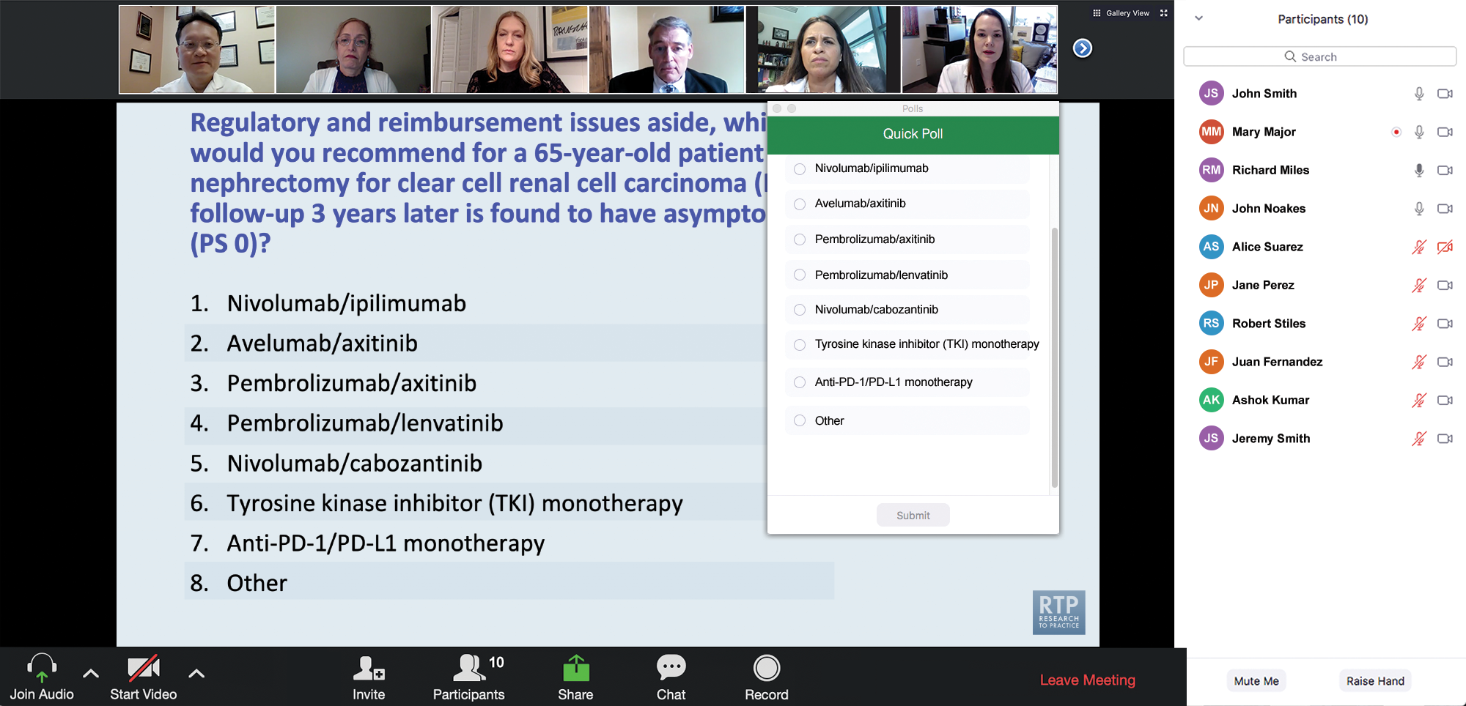
Clinicians in the Audience, Please Complete the Pre- and Postmeeting Surveys
Quick Survey
Quick Poll

Slide 13
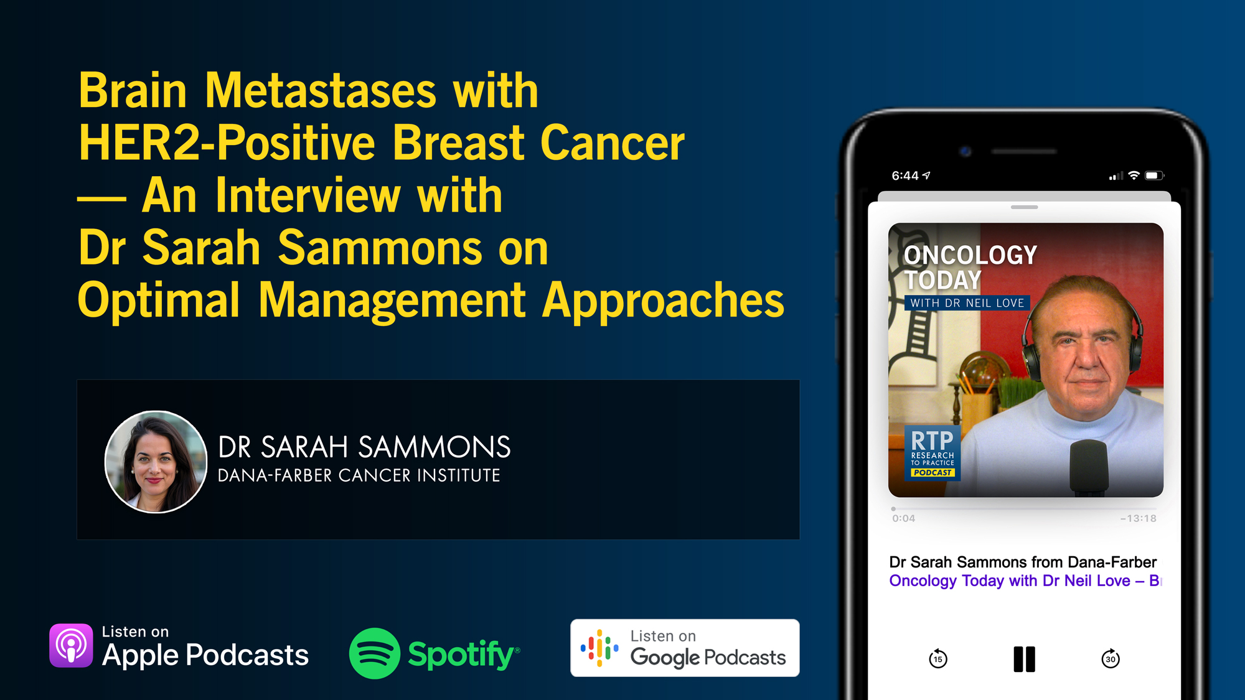

Slide 14
Consensus or Controversy? Clinical Investigators Provide Perspectives on the Current and Future Care of Patients with Relapsed/Refractory Multiple Myeloma
Part 1 of a 2-Part CME/MOC-, NCPD- and ACPE-Accredited Satellite Symposium Series During the Society of Hematologic Oncology 2025 Annual Meeting
Thursday, September 4, 2025
6:42 PM – 7:42 PM CT
Faculty
Meletios-Athanasios (Thanos) C Dimopoulos, MD
Hans Lee, MD
Noopur Raje, MD
Moderator
Joseph Mikhael, MD, MEd

Slide 15
Consensus or Controversy? Clinical Investigators
Provide Perspectives on the Current and Future Care of Patients with Follicular Lymphoma
Part 2 of a 2-Part CME/MOC-, NCPD- and ACPE-Accredited Satellite Symposium Series During the Society of Hematologic Oncology 2025 Annual Meeting
Friday, September 5, 2025
11:47 AM – 12:47 PM CT
Faculty
Jennifer Crombie, MD
Laurie H Sehn, MD, MPH
Moderator
Jeremy S Abramson, MD, MMSc

Slide 16
The Implications of Recent Datasets for the Current and
Future Management of Non-Hodgkin Lymphoma
A CME/MOC-Accredited Live Webinar
Wednesday, September 17, 2025
5:00 PM – 6:00 PM ET
Faculty
Carla Casulo, MD
Brad S Kahl, MD
Moderator
Neil Love, MD

Slide 17
Data + Perspectives: Clinical Investigators Explore the
Application of Recent Datasets in Current Oncology Care
A Multitumor Symposium in Partnership with Florida Cancer Specialists & Research Institute
Saturday, October 11, 2025
7:15 AM – 12:30 PM ET
The Ritz-Carlton Orlando, Grande Lakes | Orlando, Florida
Faculty
Emmanuel S Antonarakis, MD
Matthew P Goetz, MD
Christopher Lieu, MD
Matthew Lunning, DO
Heather McArthur, MD, MPH
Sonali M Smith, MD
John Strickler, MD
Additional faculty to be announced.
Moderator
Neil Love, MD

Slide 18
Cancer Q&A: Understanding the Role and Reality of CAR (Chimeric Antigen Receptor) T-Cell Therapy for Non-Hodgkin Lymphoma
A Webinar Series for Clinicians and Patients,
Developed in Partnership with CancerCare®
Patients
Clinicians
Wednesday, October 22, 2025
6:00 PM – 7:00 PM ET
Wednesday, November 12, 2025
5:00 PM – 6:00 PM ET
Faculty
Jeremy S Abramson, MD, MMSc
Loretta J Nastoupil, MD
Moderator
Neil Love, MD

Slide 19
Addressing Current Knowledge and Practice Gaps in the Community — Optimizing the Use of Oral Selective Estrogen
Receptor Degraders for Metastatic Breast Cancer, Part 2
A CME/MOC-Accredited Live Webinar
Wednesday, October 29, 2025
5:00 PM – 6:00 PM ET
Faculty
Rinath M Jeselsohn, MD
Joyce O’Shaughnessy, MD
Moderator
Neil Love, MD

Slide 20
Thank you for joining us! Please take a moment to complete the survey currently up on Zoom.
Your feedback is very important to us.
Information on how to obtain CME, ABIM MOC and ABS credit will be provided at the conclusion of the activity in the Zoom chat room. Attendees will also receive an email in 1 to 3 business days with these instructions.

Slide 21
Selection and Sequencing of Therapy for
Metastatic Triple-Negative Breast Cancer
A CME/MOC-Accredited Live Webinar
Thursday, August 28, 2025
5:00 PM – 6:00 PM ET
Faculty
Ana C Garrido-Castro, MD
Professor Peter Schmid, FRCP, MD, PhD
Moderator
Neil Love, MD

Slide 22
Faculty
Ana C Garrido-Castro, MD
Assistant Professor of Medicine
Harvard Medical School
Director, Triple-Negative Breast Cancer Research
Susan F Smith Center for Women's Cancers
Department of Medical Oncology
Dana-Farber Cancer Institute
Boston, Massachusetts
MODERATOR
Neil Love, MD
Research To Practice
Miami, Florida
Professor Peter Schmid, FRCP, MD, PhD
Lead, Centre of Experimental Cancer Medicine
Barts Cancer Institute
London, United Kingdom

Slide 23
We Encourage Clinicians in Practice to Submit Questions
Feel free to submit questions now before the program begins and throughout the program.

Slide 24
Clinicians in the Audience, Please Complete the Pre- and Postmeeting Surveys
Quick Survey
Quick Poll

Slide 26
RTP Content Distribution Platform
9-28-24 to 9-28-25
Podcast
Streaming Platforms
(YouTube, Spotify)
 | Year | Month
Total (hours) | 280 | 24
Recordings | 93 | 7
Webinars | 41 | 4
Cases | 62 | 5
Meetings | 84 | 7
Final | 218 | 18
Email
Social Media
App
Website
Text Messages
QR Code Cards

Slide 27
Consensus or Controversy? Clinical Investigators Provide Perspectives on the Current and Future Care of Patients with Relapsed/Refractory Multiple Myeloma
Part 1 of a 2-Part CME/MOC-, NCPD- and ACPE-Accredited Satellite Symposium Series During the Society of Hematologic Oncology 2025 Annual Meeting
Thursday, September 4, 2025
6:42 PM – 7:42 PM CT
Faculty
Meletios-Athanasios (Thanos) C Dimopoulos, MD
Hans Lee, MD
Noopur Raje, MD
Moderator
Joseph Mikhael, MD, MEd

Slide 28
Consensus or Controversy? Clinical Investigators
Provide Perspectives on the Current and Future Care of Patients with Follicular Lymphoma
Part 2 of a 2-Part CME/MOC-, NCPD- and ACPE-Accredited Satellite Symposium Series During the Society of Hematologic Oncology 2025 Annual Meeting
Friday, September 5, 2025
11:47 AM – 12:47 PM CT
Faculty
Jennifer Crombie, MD
Laurie H Sehn, MD, MPH
Moderator
Jeremy S Abramson, MD, MMSc

Slide 29
The Implications of Recent Datasets for the Current and
Future Management of Non-Hodgkin Lymphoma
A CME/MOC-Accredited Live Webinar
Wednesday, September 17, 2025
5:00 PM – 6:00 PM ET
Faculty
Carla Casulo, MD
Brad S Kahl, MD
Moderator
Neil Love, MD

Slide 30
Data + Perspectives: Clinical Investigators Explore the
Application of Recent Datasets in Current Oncology Care
A Multitumor Symposium in Partnership with Florida Cancer Specialists & Research Institute
Saturday, October 11, 2025
7:15 AM – 12:30 PM ET
The Ritz-Carlton Orlando, Grande Lakes | Orlando, Florida
Faculty
Emmanuel S Antonarakis, MD
Matthew P Goetz, MD
Christopher Lieu, MD
Matthew Lunning, DO
Heather McArthur, MD, MPH
Sonali M Smith, MD
John Strickler, MD
Additional faculty to be announced.
Moderator
Neil Love, MD

Slide 31
Cancer Q&A: Understanding the Role and Reality of CAR (Chimeric Antigen Receptor) T-Cell Therapy for Non-Hodgkin Lymphoma
A Webinar Series for Clinicians and Patients,
Developed in Partnership with CancerCare®
Patients
Clinicians
Wednesday, October 22, 2025
6:00 PM – 7:00 PM ET
Wednesday, November 12, 2025
5:00 PM – 6:00 PM ET
Faculty
Jeremy S Abramson, MD, MMSc
Loretta J Nastoupil, MD
Moderator
Neil Love, MD

Slide 32
Addressing Current Knowledge and Practice Gaps in the Community — Optimizing the Use of Oral Selective Estrogen
Receptor Degraders for Metastatic Breast Cancer, Part 2
A CME/MOC-Accredited Live Webinar
Wednesday, October 29, 2025
5:00 PM – 6:00 PM ET
Faculty
Rinath M Jeselsohn, MD
Joyce O’Shaughnessy, MD
Moderator
Neil Love, MD

Slide 33
Selection and Sequencing of Therapy for
Metastatic Triple-Negative Breast Cancer
A CME/MOC-Accredited Live Webinar
Thursday, August 28, 2025
5:00 PM – 6:00 PM ET
Faculty
Ana C Garrido-Castro, MD
Professor Peter Schmid, FRCP, MD, PhD
Moderator
Neil Love, MD

Slide 34
Dr Garrido-Castro — Disclosures
Advisory Committees | AstraZeneca Pharmaceuticals LP, Daiichi Sankyo Inc, Gilead Sciences Inc, Novartis, Pfizer Inc
Consulting Agreements | AstraZeneca Pharmaceuticals LP, Daiichi Sankyo Inc, Gilead Sciences Inc, Novartis, Pfizer Inc, TD Cowen
Contracted Research | 4D Path, AstraZeneca Pharmaceuticals LP, Bicycle Therapeutics, Biovica International AB, Bristol Myers Squibb, Daiichi Sankyo Inc, Foundation Medicine, Gilead Sciences Inc, Merck, Novartis, Precede Biosciences, Zenith Epigenetics
Speaker/Honoraria | AstraZeneca Pharmaceuticals LP, Bicycle Therapeutics, Daiichi Sankyo Inc, Genentech, a member of the Roche Group, Gilead Sciences Inc
Travel/Other Support | AstraZeneca Pharmaceuticals LP, Daiichi Sankyo Inc, Genentech, a member of the Roche Group, Gilead Sciences Inc, Merck, Novartis, Pfizer Inc

Slide 35
Prof Schmid — Disclosures
Advisory Committees and Consulting Agreements | AstraZeneca Pharmaceuticals LP, Bayer HealthCare Pharmaceuticals, Boehringer Ingelheim Pharmaceuticals Inc, Celgene Corporation, Eisai Inc, Merck, Novartis, Pfizer Inc, Puma Biotechnology Inc, Roche Laboratories Inc
Contracted Research | Astellas, AstraZeneca Pharmaceuticals LP, Genentech, a member of the Roche Group, Medivation Inc, a Pfizer Company, Merck, Novartis, OncoGenex Pharmaceuticals Inc, Roche Laboratories Inc

Slide 36
Dr Love — Disclosures
Dr Love is president and CEO of Research To Practice. Research To Practice receives funds in the form of educational grants to develop CME activities from the following companies: Aadi Bioscience, AbbVie Inc, ADC Therapeutics, Alexion Pharmaceuticals, Amgen Inc, Array BioPharma Inc, a subsidiary of Pfizer Inc, Arvinas, Astellas, AstraZeneca Pharmaceuticals LP, Aveo Pharmaceuticals, Bayer HealthCare Pharmaceuticals, BeOne, Black Diamond Therapeutics Inc, Blueprint Medicines, Boehringer Ingelheim Pharmaceuticals Inc, Bristol Myers Squibb, Clovis Oncology, Coherus BioSciences, CTI BioPharma, a Sobi Company, Daiichi Sankyo Inc, Eisai Inc, Elevation Oncology Inc, Exact Sciences Corporation, Exelixis Inc, Genentech, a member of the Roche Group, Genmab US Inc, Geron Corporation, Gilead Sciences Inc, GSK, Hologic Inc, ImmunoGen Inc, Incyte Corporation, Ipsen Biopharmaceuticals Inc, Jazz Pharmaceuticals Inc, Johnson & Johnson, Karyopharm Therapeutics, Kite, A Gilead Company, Kura Oncology, Legend Biotech, Lilly, MEI Pharma Inc, Merck, Mersana Therapeutics Inc, Mirati Therapeutics Inc, Mural Oncology Inc, Natera Inc, Novartis, Novartis Pharmaceuticals Corporation on behalf of Advanced Accelerator Applications, Novocure Inc, Nuvalent, Pfizer Inc, Pharmacyclics LLC, an AbbVie Company, Puma Biotechnology Inc, Regeneron Pharmaceuticals Inc, Rigel Pharmaceuticals Inc, R-Pharm US, Sanofi, Seagen Inc, Servier Pharmaceuticals LLC, SpringWorks Therapeutics Inc, Stemline Therapeutics Inc, Syndax Pharmaceuticals, Taiho Oncology Inc, Takeda Pharmaceuticals USA Inc, TerSera Therapeutics LLC, and Tesaro, A GSK Company.

Slide 37
Commercial Support
This activity is supported by an educational grant from Gilead Sciences Inc.
Research To Practice CME Planning Committee Members,
Staff and Reviewers
Planners, scientific staff and independent reviewers for Research To Practice have no relevant conflicts of interest to disclose.

Slide 38
This educational activity contains discussion of
non-FDA-approved uses of agents and regimens. Please refer to official prescribing information for each product for approved indications.

Slide 39
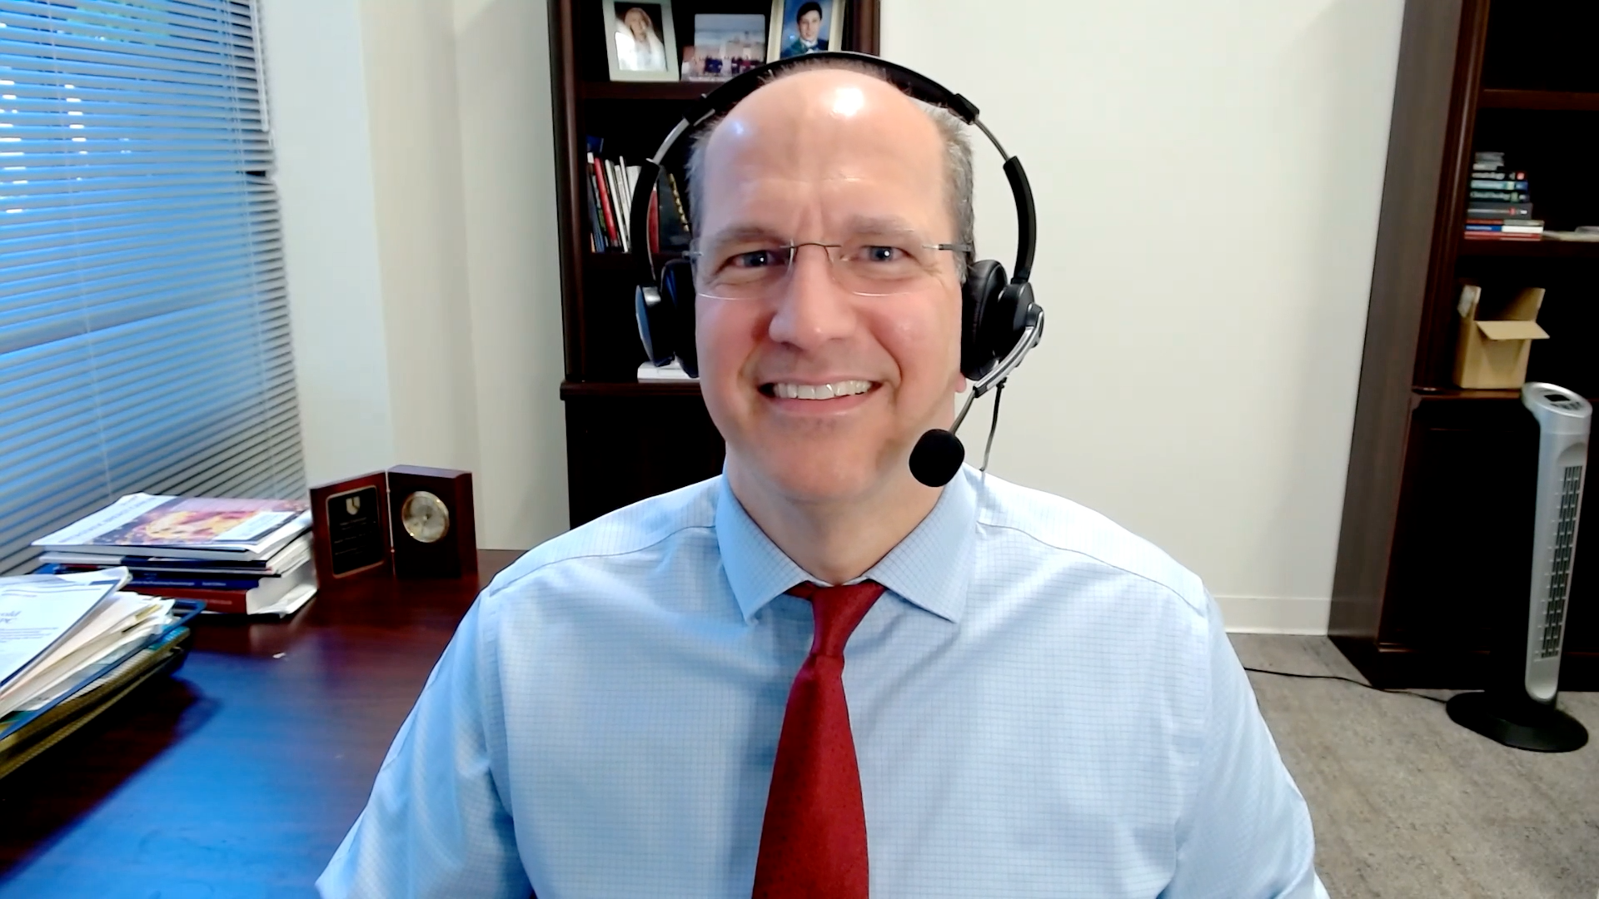
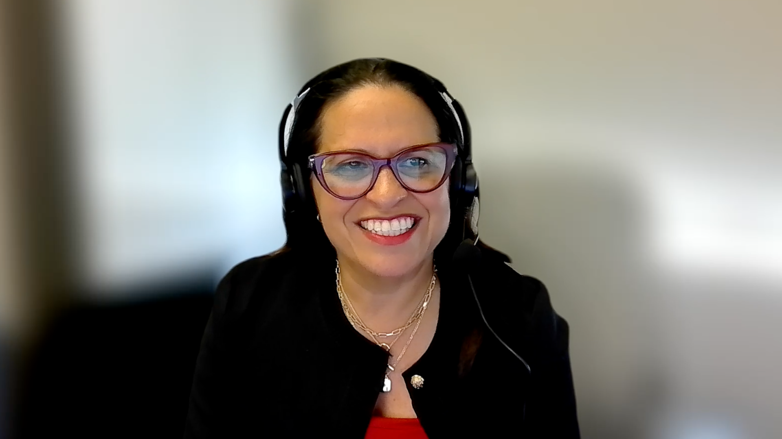
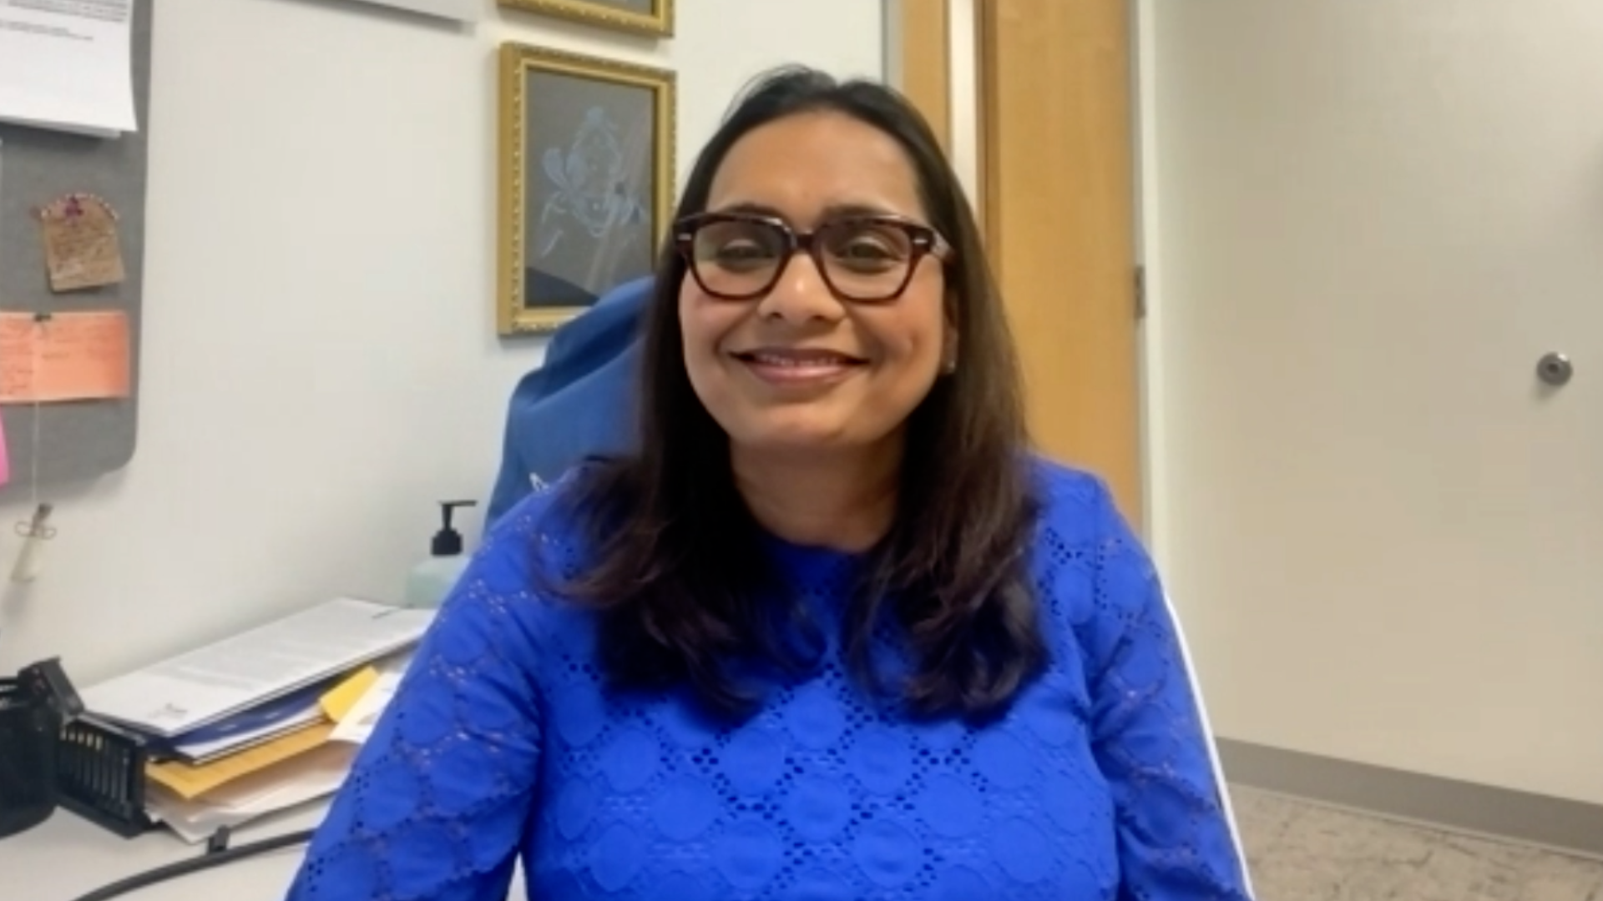
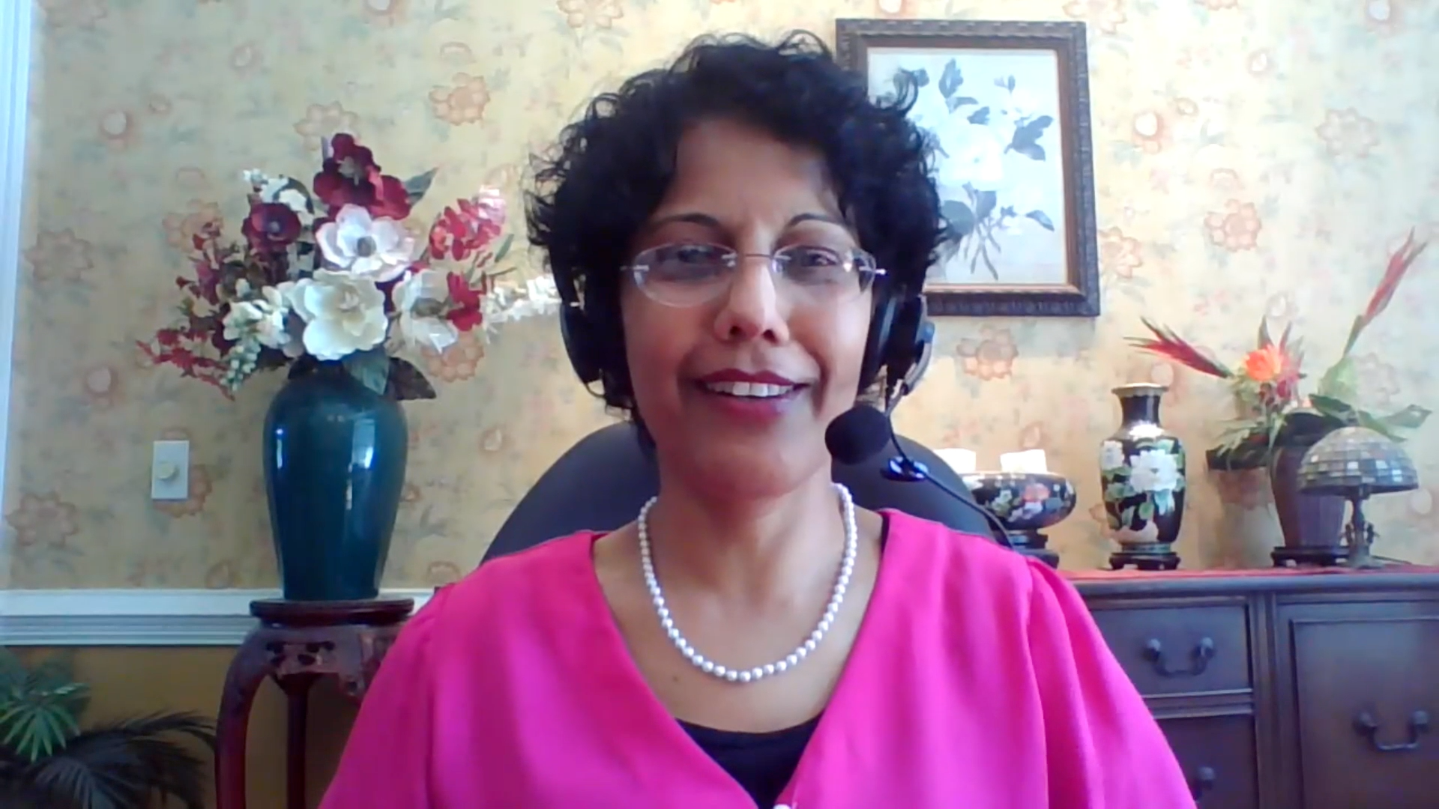
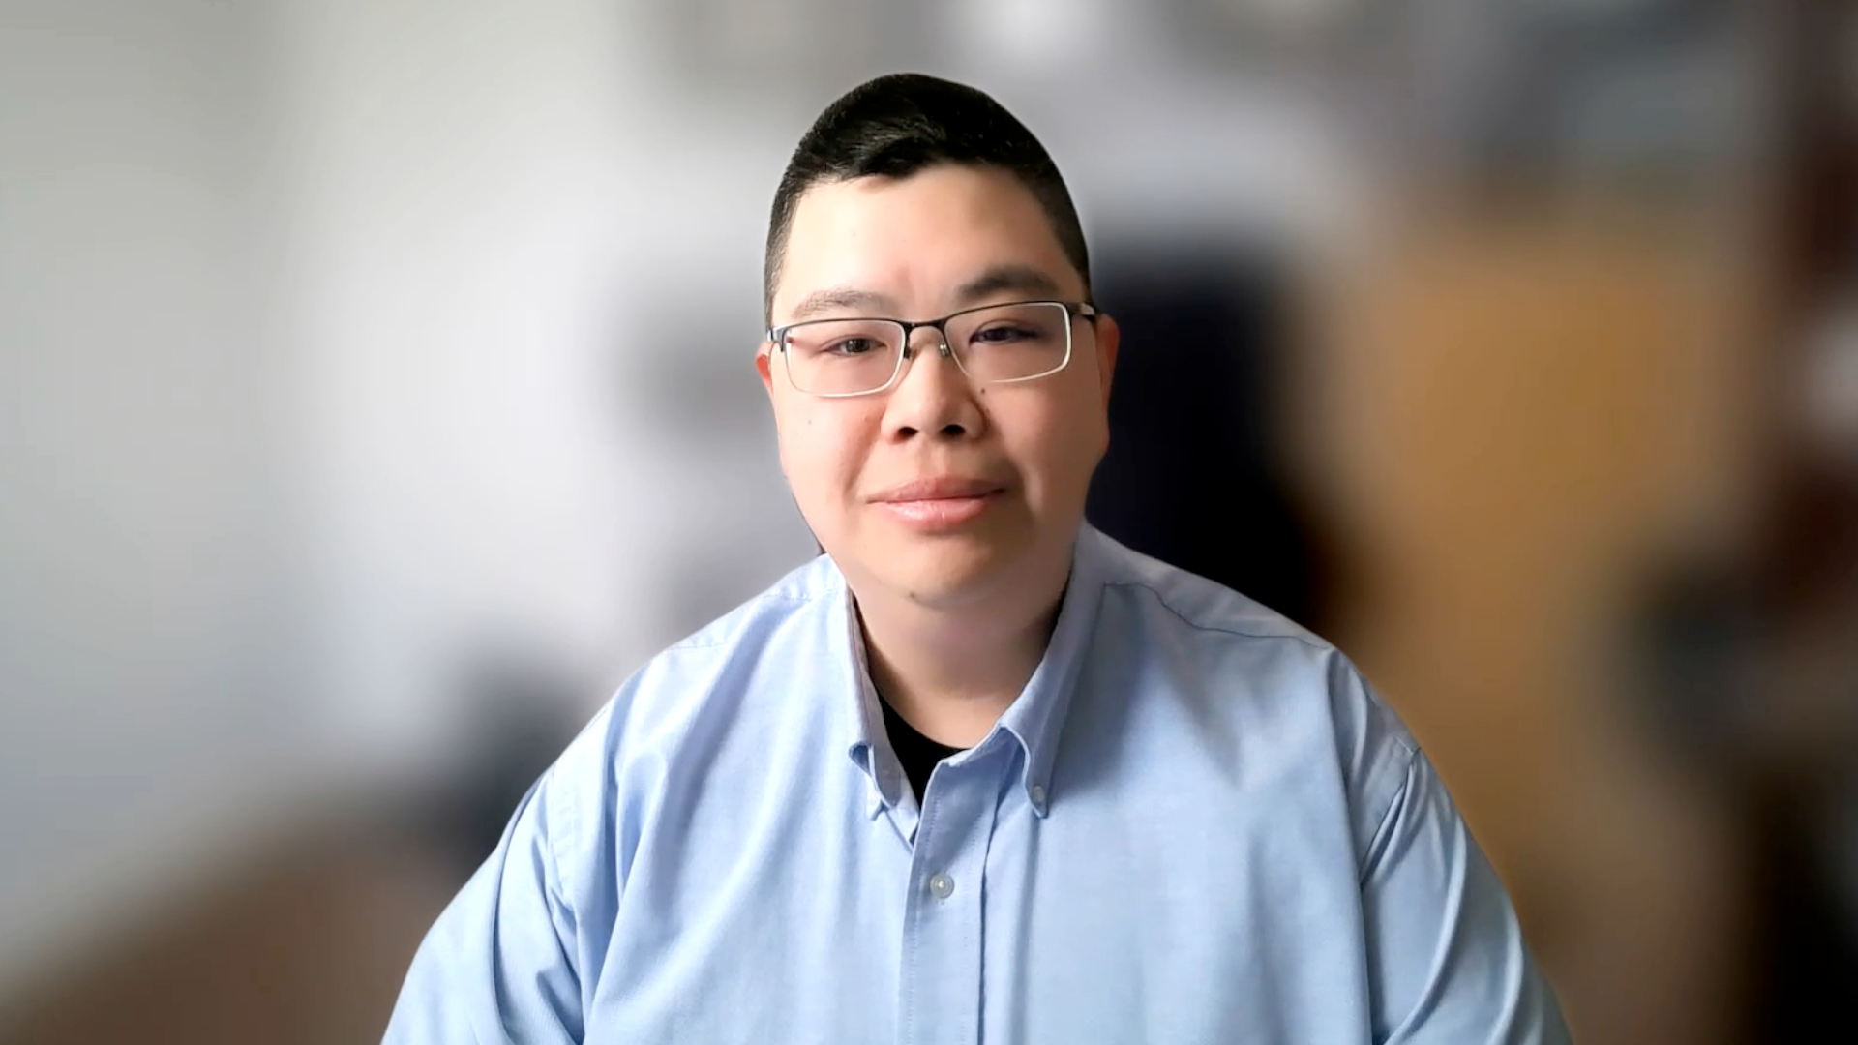
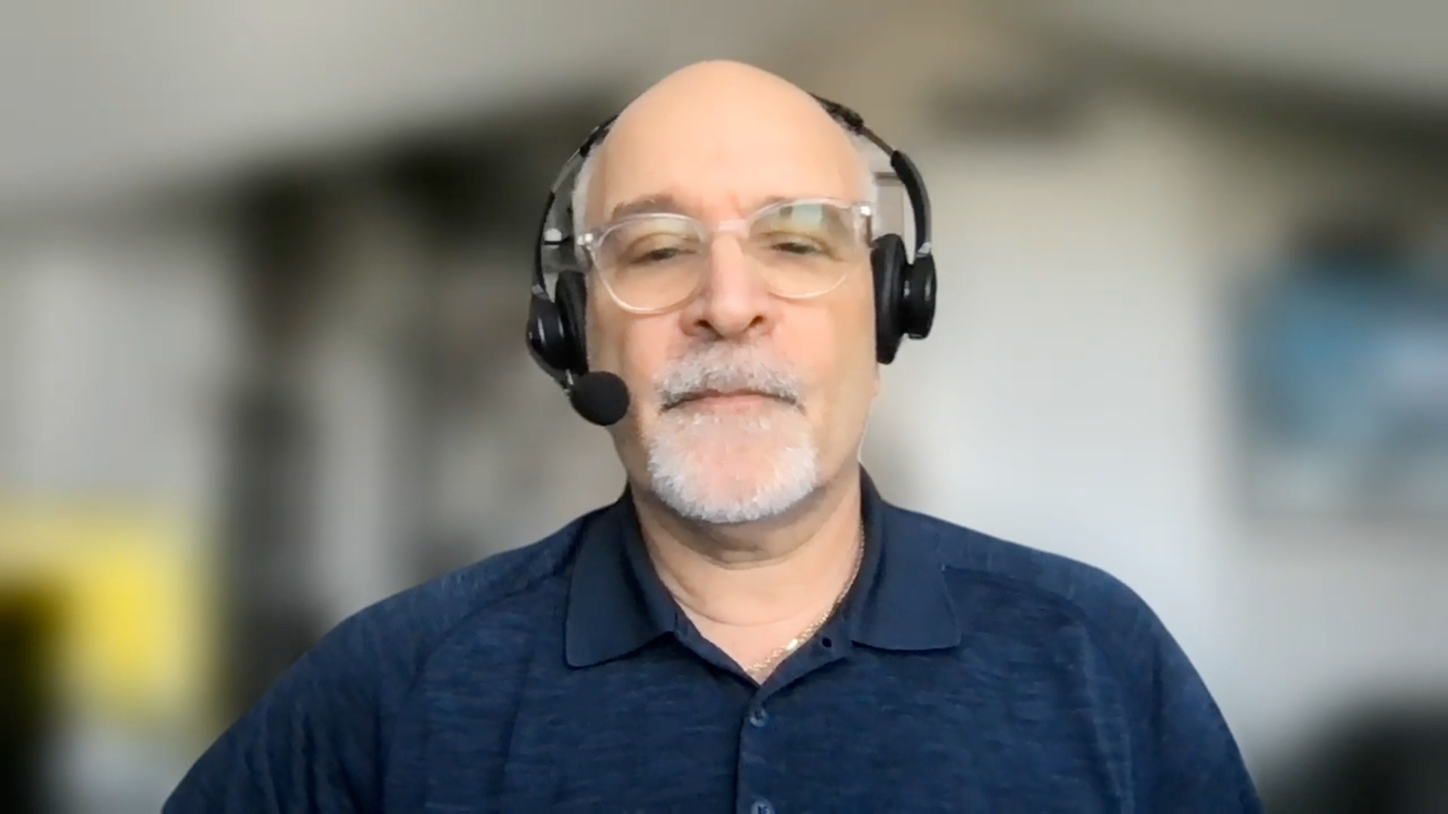
Contributing General Medical Oncologists
Justin Favaro, MD, PhD
Oncology Specialists of Charlotte
Charlotte, North Carolina
Estelamari Rodriguez, MD, MPH
Sylvester Comprehensive
Cancer Center
Miami, Florida
Ranju Gupta, MD
Lehigh Valley Topper Cancer Institute
Bethlehem, Pennsylvania
Priya Rudolph, MD, PhD
Georgia Cancer Specialists
Northside Hospital Cancer Institute
Athens, Georgia
Eric H Lee, MD, PhD
Compassionate Cancer Care Medical Group
Fountain Valley, California
Richard Zelkowitz, MD
Hartford HealthCare Cancer Institute
Bridgeport, Connecticut

Slide 40
Agenda
Introduction: Legendary Figures in Breast Cancer Research
Case 1: Dr Favaro – 82-year-old woman, a current smoker with PMH of myocardial infarction
and stroke, develops recurrent TNBC
Case 2: Dr Rudolph – 67-year-old woman with mTNBC (PD-L1 20%) receives chemotherapy/ pembrolizumab followed by sacituzumab govitecan
Case 3: Dr Zelkowitz – 68-year-old woman with localized TNBC develops myocarditis during neoadjuvant chemotherapy/pembrolizumab
Case 4: Dr Gupta – 64-year-old woman with recurrent ER-negative, HER2-low, PI3K-
mutant mTNBC
Case 5: Dr Lee – 63-year-old woman with recurrent TNBC confined to contralateral neck nodes
Case 6: Dr Rodriguez – 43-year-old woman with mTNBC s/p multiple lines of chemotherapy receives sacituzumab govitecan
Case 7: Dr Gupta – 76-year-old woman with ER-negative, HER2-low breast cancer develops
an isolated brain metastasis
Case 8: Dr Rudolph – 68-year-old woman with mTNBC experiences severe diarrhea with
sacituzumab govitecan

Slide 41
Agenda
Introduction: Legendary Figures in Breast Cancer Research
Case 1: Dr Favaro – 82-year-old woman, a current smoker with PMH of myocardial infarction
and stroke, develops recurrent TNBC
Case 2: Dr Rudolph – 67-year-old woman with mTNBC (PD-L1 20%) receives chemotherapy/ pembrolizumab followed by sacituzumab govitecan
Case 3: Dr Zelkowitz – 68-year-old woman with localized TNBC develops myocarditis during neoadjuvant chemotherapy/pembrolizumab
Case 4: Dr Gupta – 64-year-old woman with recurrent ER-negative, HER2-low, PI3K-
mutant mTNBC
Case 5: Dr Lee – 63-year-old woman with recurrent TNBC confined to contralateral neck nodes
Case 6: Dr Rodriguez – 43-year-old woman with mTNBC s/p multiple lines of chemotherapy receives sacituzumab govitecan
Case 7: Dr Gupta – 76-year-old woman with ER-negative, HER2-low breast cancer develops
an isolated brain metastasis
Case 8: Dr Rudolph – 68-year-old woman with mTNBC experiences severe diarrhea with
sacituzumab govitecan

Slide 42


Dan Marino
Bernie Kosar

Slide 43
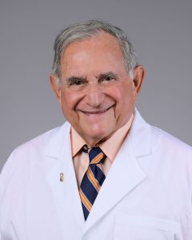
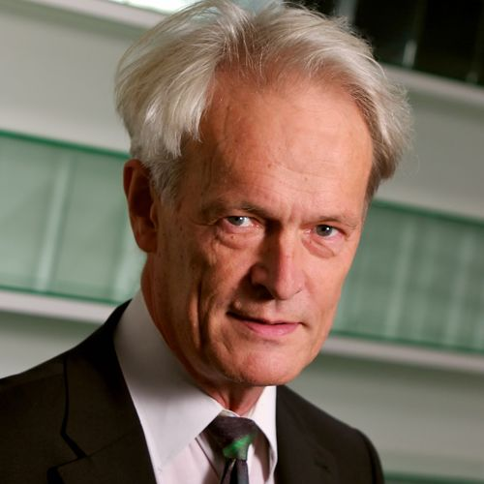
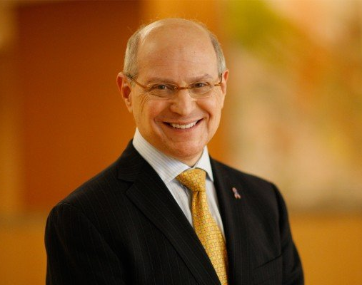
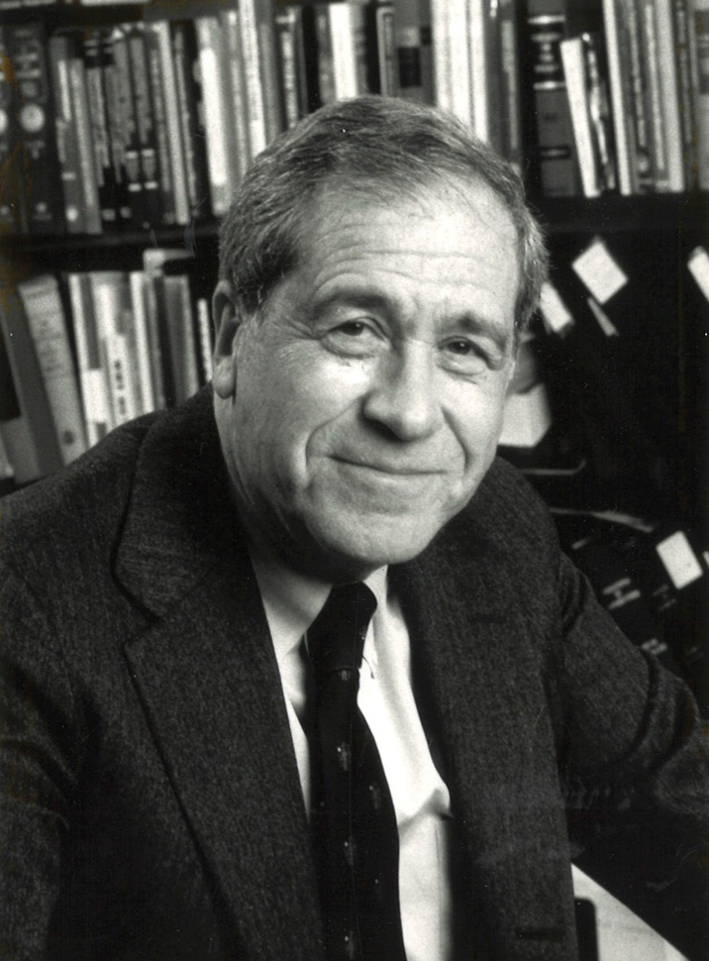
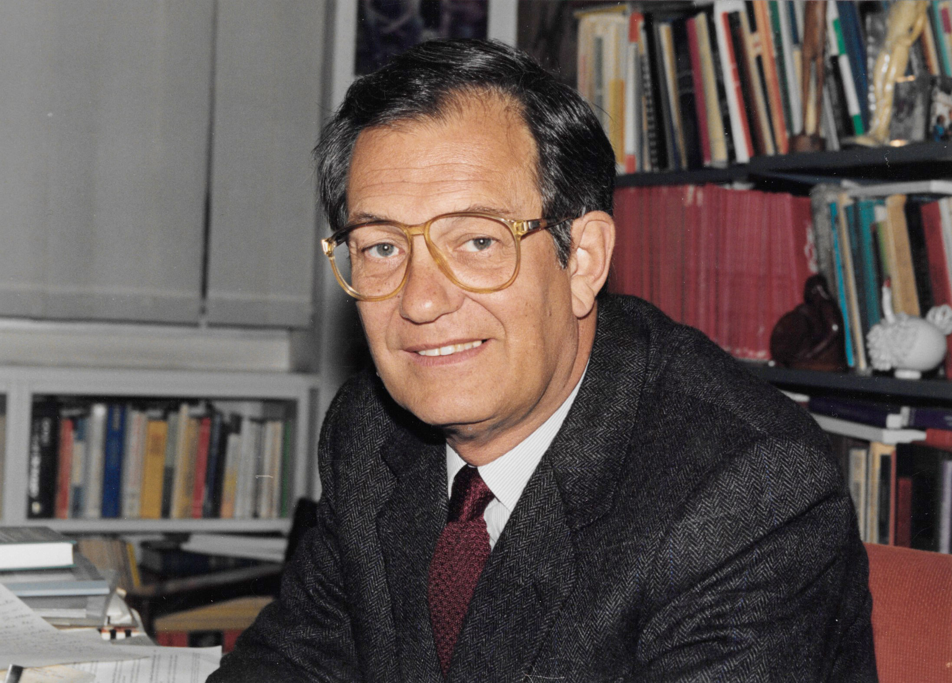
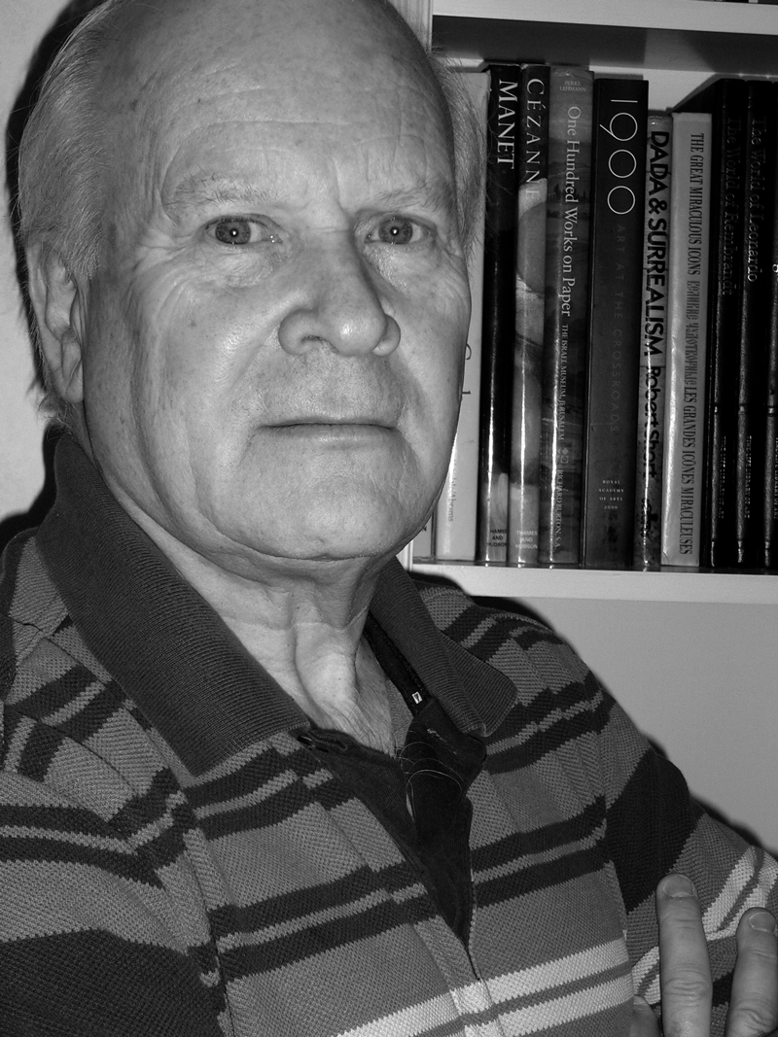
Larry Norton
Richard Peto
Chuck Vogel
Michael Baum
Gianni Bonadonna
Bernard Fisher

Slide 44
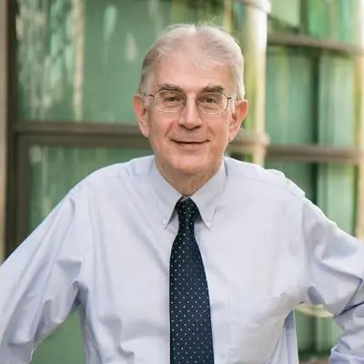
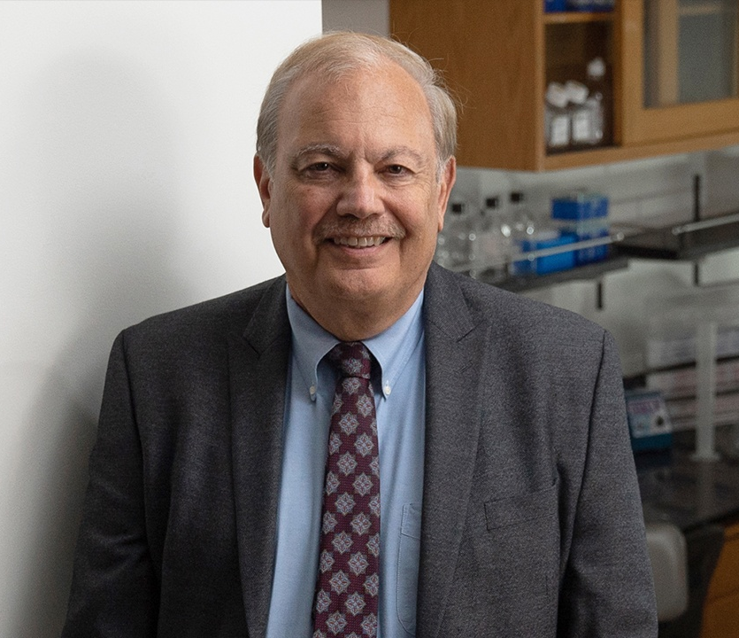
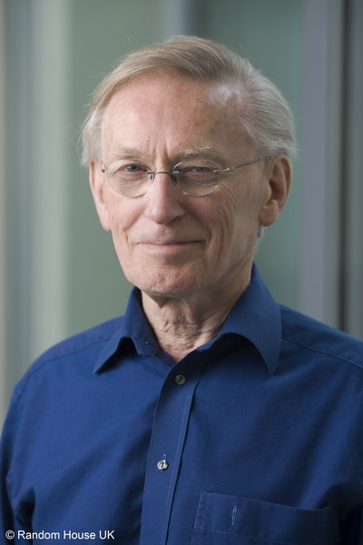

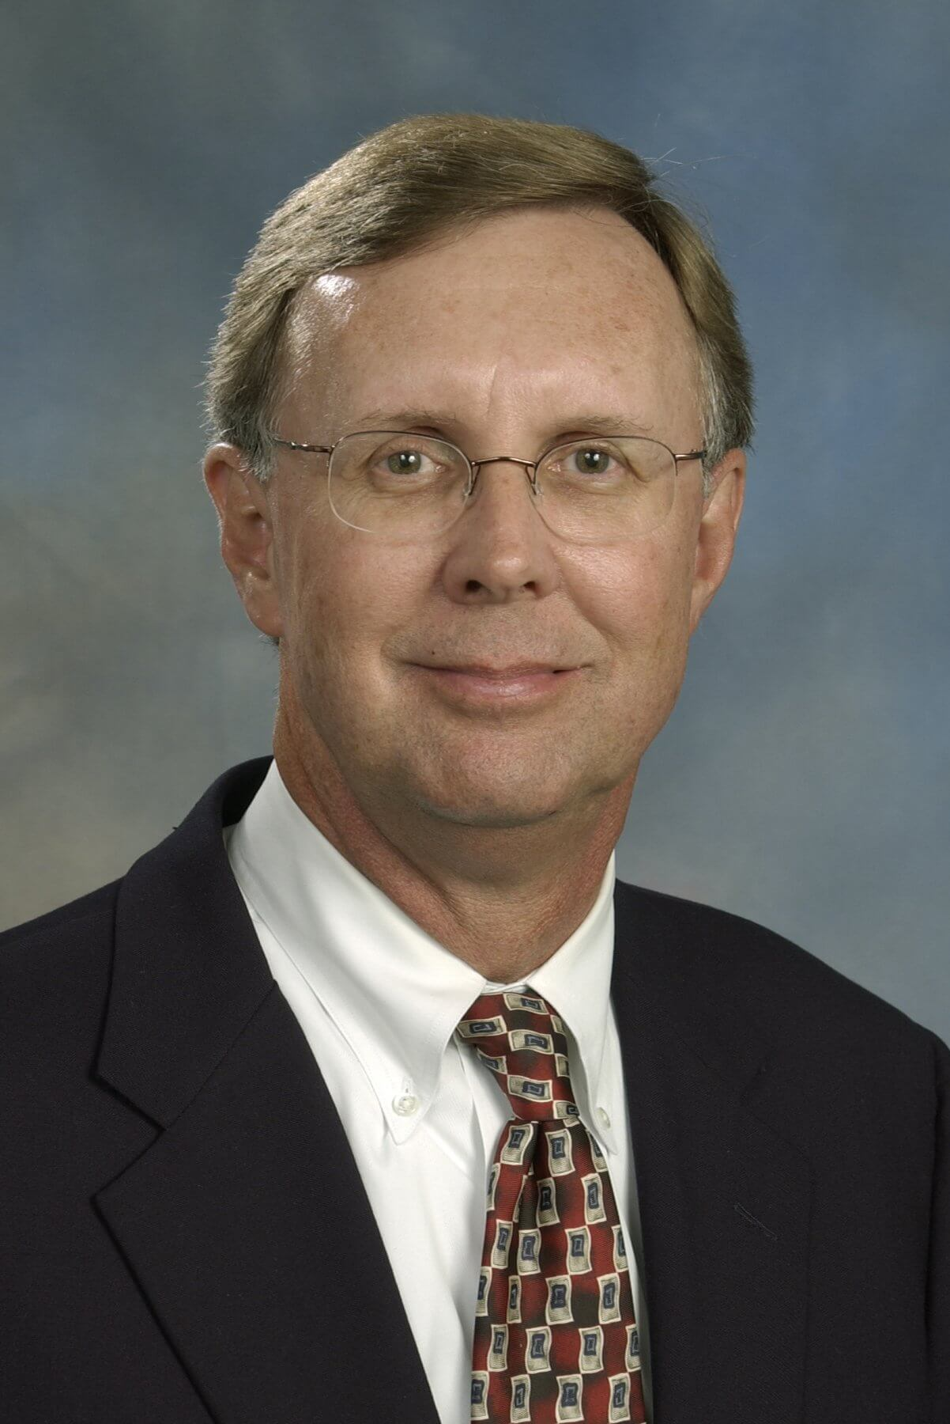
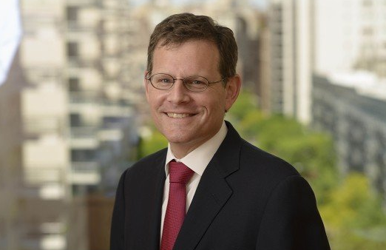
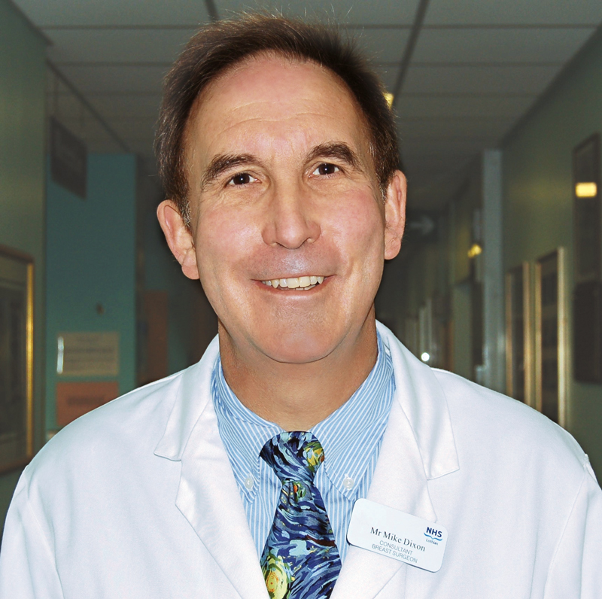
George Sledge
Dennis Slamon
Tony Howell
John Robertson
Kent Osborne
Cliff Hudis
Michael Dixon

Slide 45
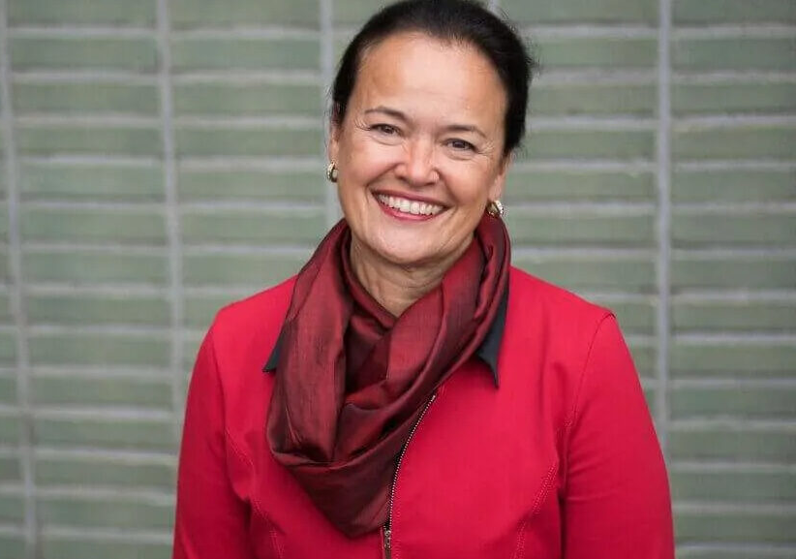
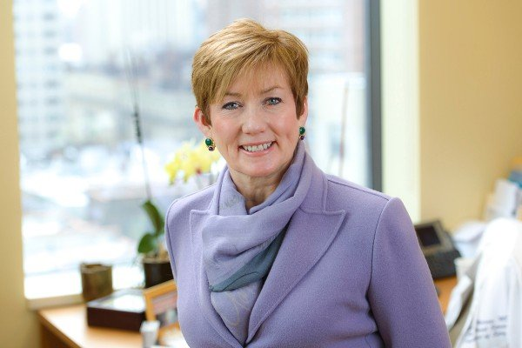


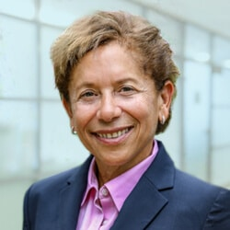
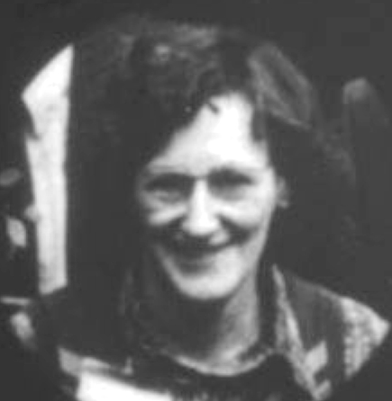
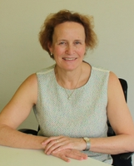
Martine Piccart
Monica Morrow
Hyman Muss
Craig Jordan
Edith Perez
Helen Stewart
Kathy Pritchard

Slide 46
Agenda
Introduction: Legendary Figures in Breast Cancer Research
Case 1: Dr Favaro – 82-year-old woman, a current smoker with PMH of myocardial infarction
and stroke, develops recurrent TNBC
Case 2: Dr Rudolph – 67-year-old woman with mTNBC (PD-L1 20%) receives chemotherapy/ pembrolizumab followed by sacituzumab govitecan
Case 3: Dr Zelkowitz – 68-year-old woman with localized TNBC develops myocarditis during neoadjuvant chemotherapy/pembrolizumab
Case 4: Dr Gupta – 64-year-old woman with recurrent ER-negative, HER2-low, PI3K-
mutant mTNBC
Case 5: Dr Lee – 63-year-old woman with recurrent TNBC confined to contralateral neck nodes
Case 6: Dr Rodriguez – 43-year-old woman with mTNBC s/p multiple lines of chemotherapy receives sacituzumab govitecan
Case 7: Dr Gupta – 76-year-old woman with ER-negative, HER2-low breast cancer develops
an isolated brain metastasis
Case 8: Dr Rudolph – 68-year-old woman with mTNBC experiences severe diarrhea with
sacituzumab govitecan

Slide 47
Case Presentation: 82-year-old woman, a current smoker with PMH of myocardial infarction and stroke, develops recurrent TNBC
Dr Justin Favaro (Charlotte, North Carolina)

Slide 48
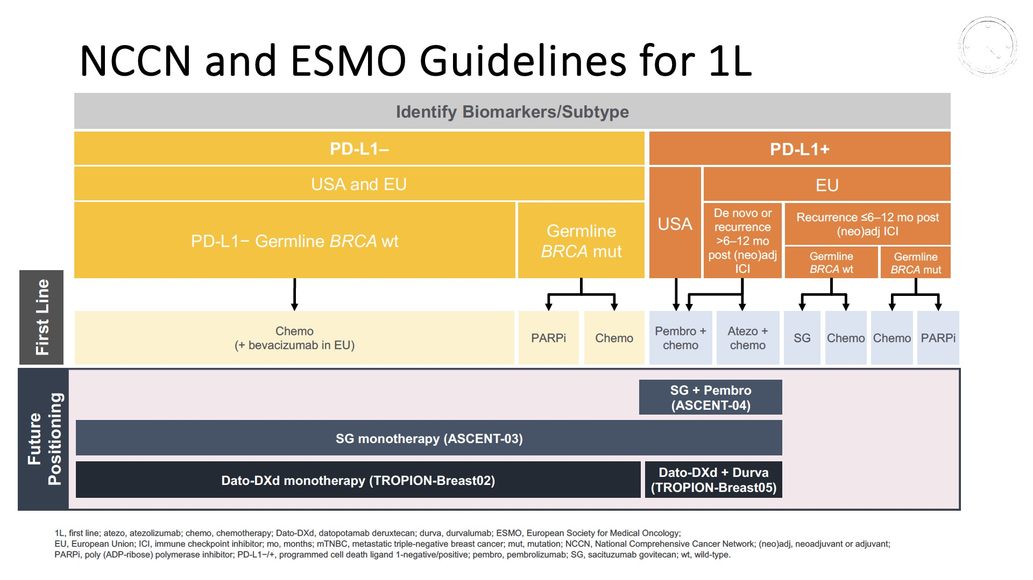
Guidelines for 1L therapy
Courtesy of Sara M Tolaney, MD, MPH

Slide 49
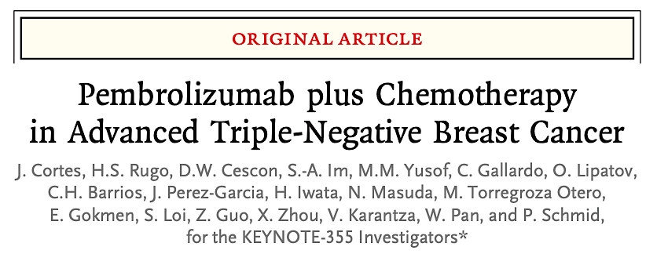
N Engl J Med 2022;387(3):217-26.

Slide 50
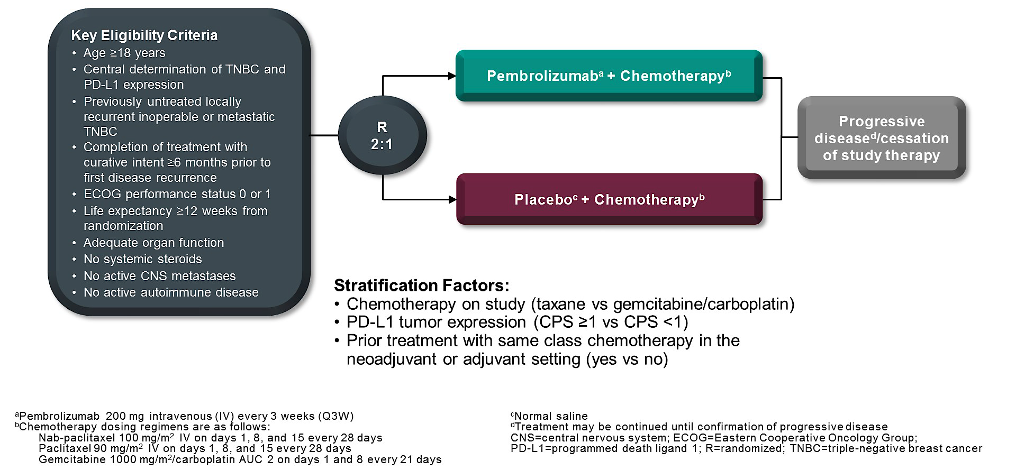
Phase III KEYNOTE-355 Study Design
Cortes J et al. N Engl J Med 2022;387(3):217-26.

Slide 51
TROP2-directed ADCs
 | Sacituzumab govitecan (IMMU-132) | Datopotamab deruxtecan (DS-1062a) | Sacituzumab tirumotecan (MK-2870)
Antibody | hRS7 Humanized IgG1 mAb | MAAP-9001a Humanized IgG1 mAb | hRS7 Humanized IgG1 mAb
Payload | SN38 (DNA Topoisomerase I inhibitor) | DXd (DNA Topoisomerase I inhibitor) | KL610023 (DNA Topoisomerase I inhibitor)
Linker cleavage | Enzymatic and pH-dependent | Enzymatic | Enzymatic and pH-dependent
Bystander effect | Yes | Yes | Yes
DAR | 7.6 | 4 | 7.4
Half-life | 11-14h | ∼5 days | 57h
Dosing | D1, D8 of Q3W schedule | Q3W | Q2W
Courtesy of Sara M Tolaney, MD, MPH
Sands J et al. ASCO 2018; Okajima D et al. ASCO 2018; Bardia A et al. ESMO Breast Cancer 2021; Cheng Y et al. Front Oncol 2022.

Slide 52
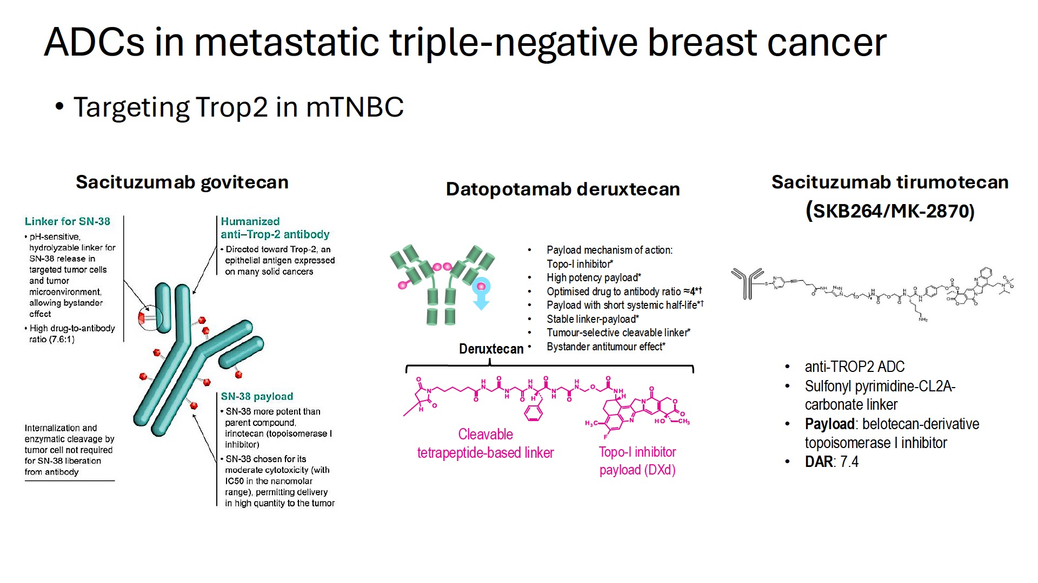
ADCs
Courtesy of Rebecca A Dent, MD, MSc

Slide 53
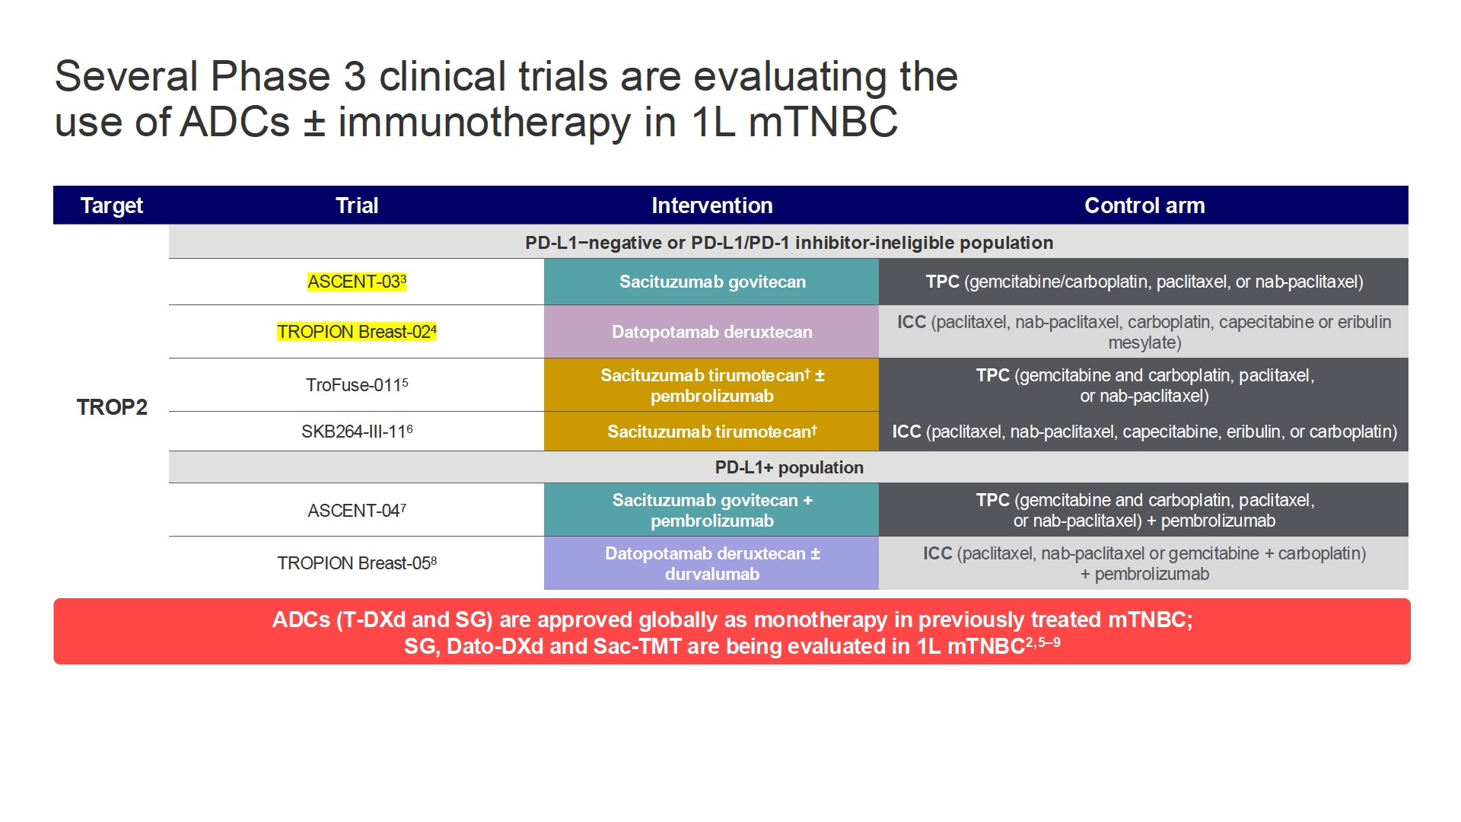
ADCS + IO for mTNBC
Courtesy of Rebecca A Dent, MD, MSc

Slide 54
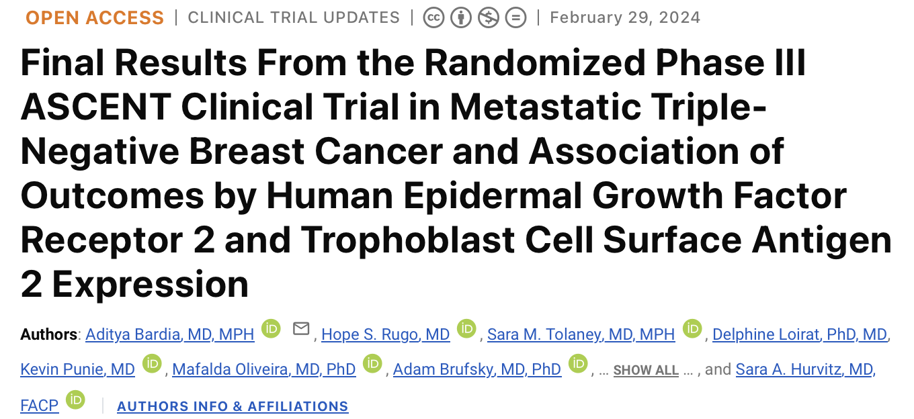

Slide 55
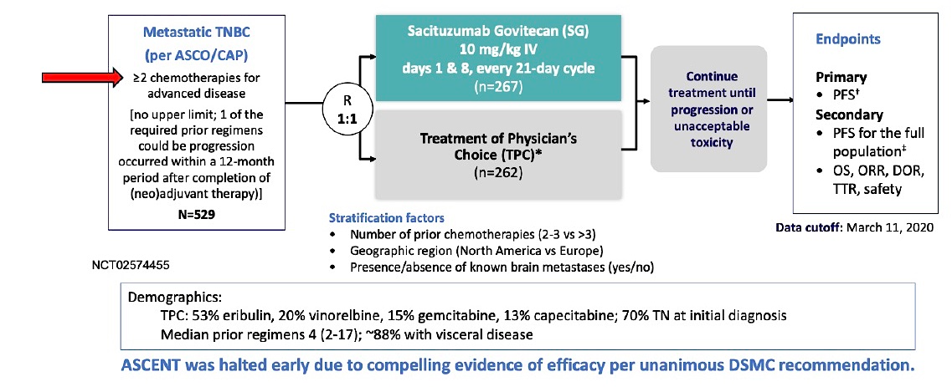
Phase III ASCENT Study Design
Bardia A et al. J Clin Oncol 2024.

Slide 56
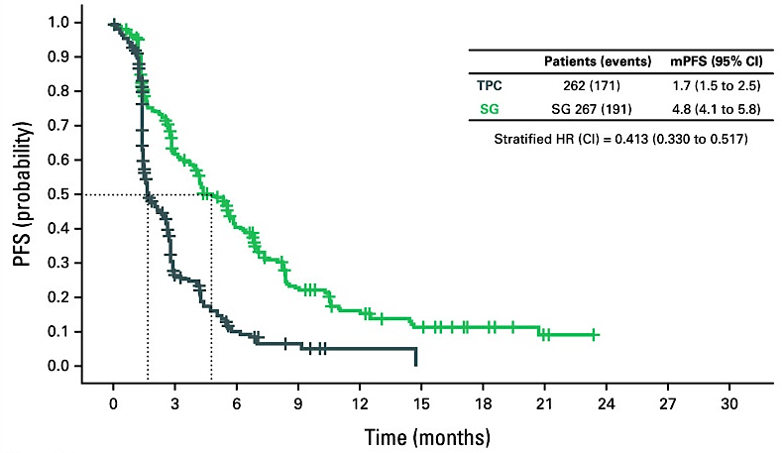
Phase III ASCENT: Progression-Free Survival (PFS)
mPFS = median progression-free survival
Bardia A et al. J Clin Oncol 2024.

Slide 57
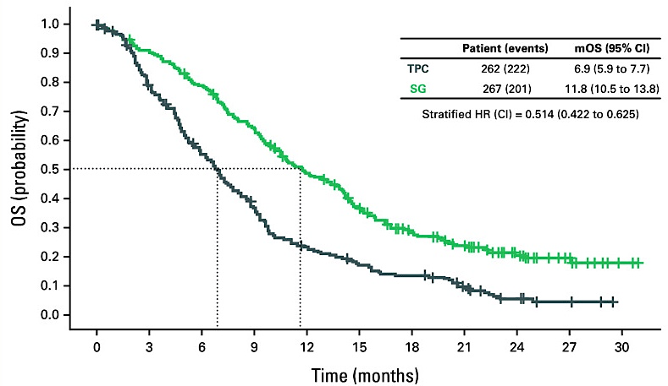
Phase III ASCENT: Overall Survival (OS)
Bardia A et al. J Clin Oncol 2024.

Slide 58
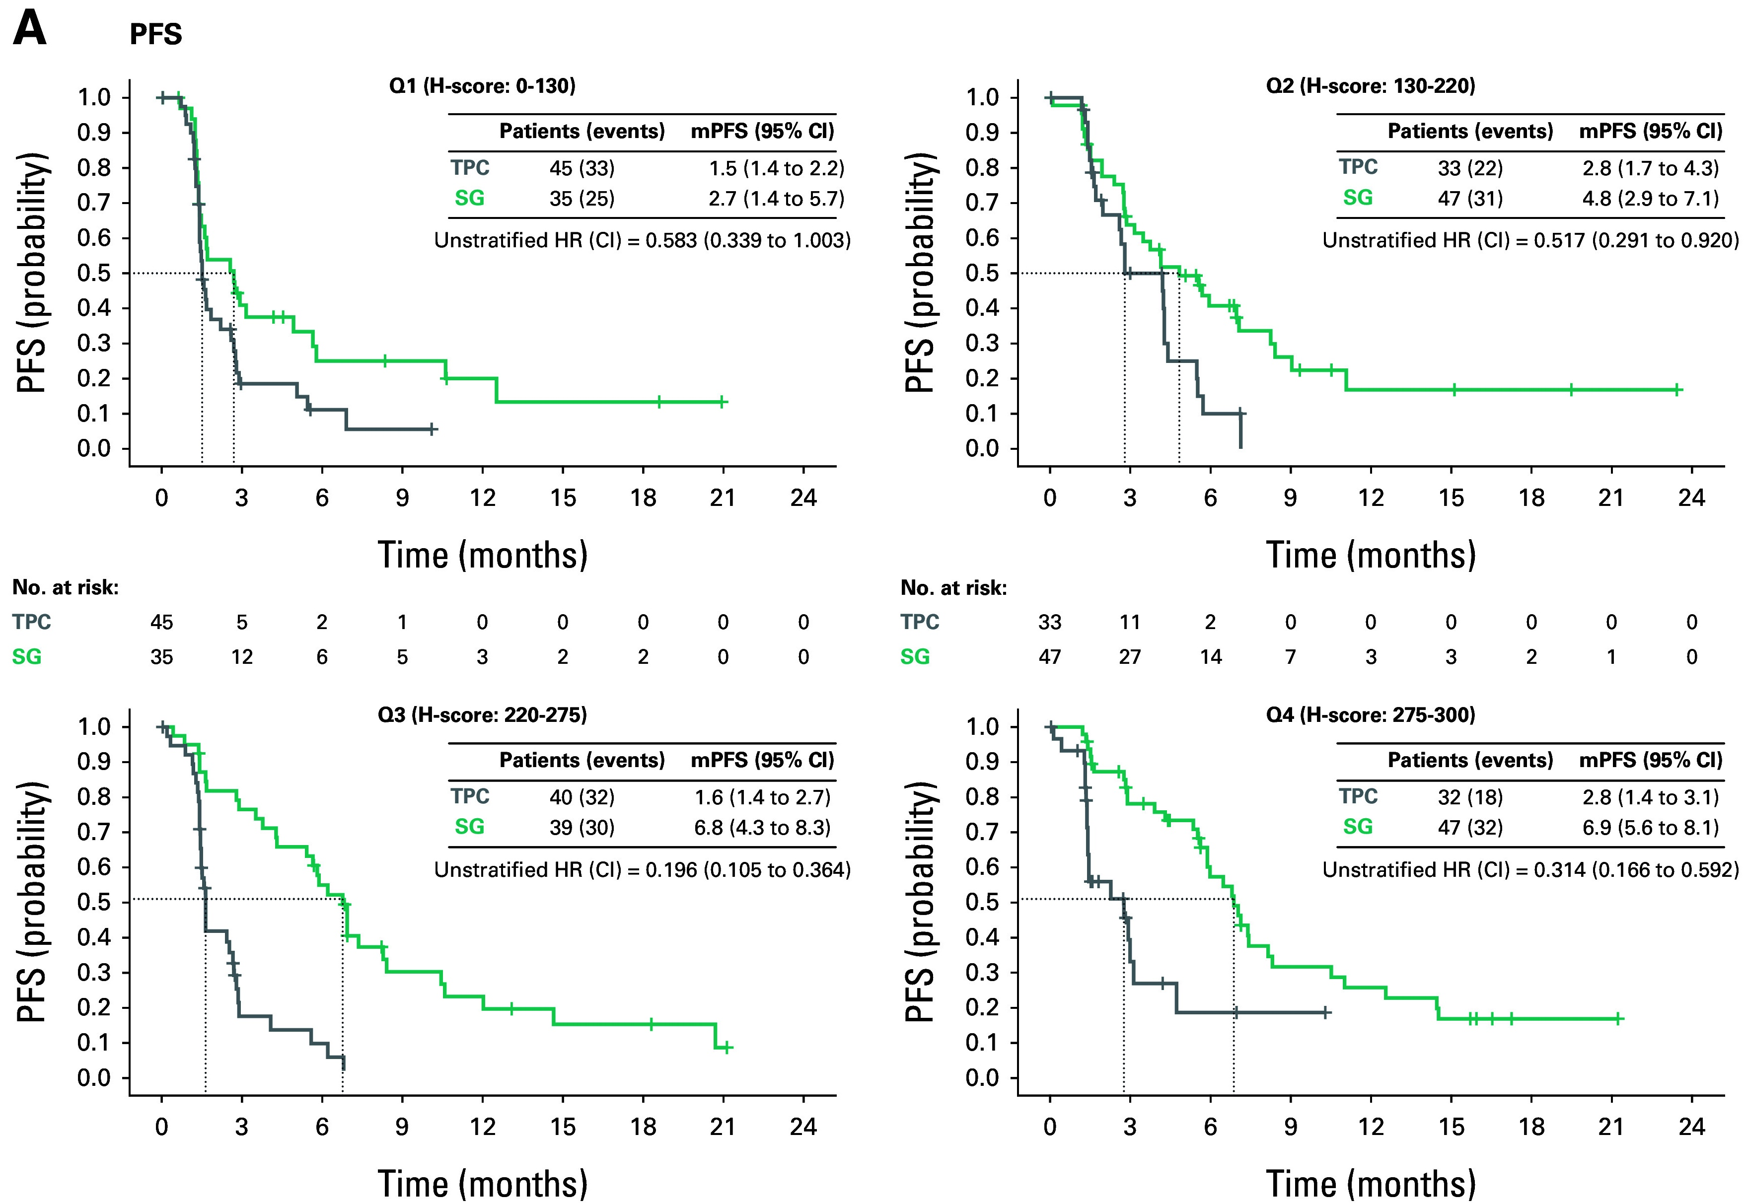
Phase III ASCENT: PFS by TROP2 Expression
Bardia A et al. J Clin Oncol 2024.

Slide 59
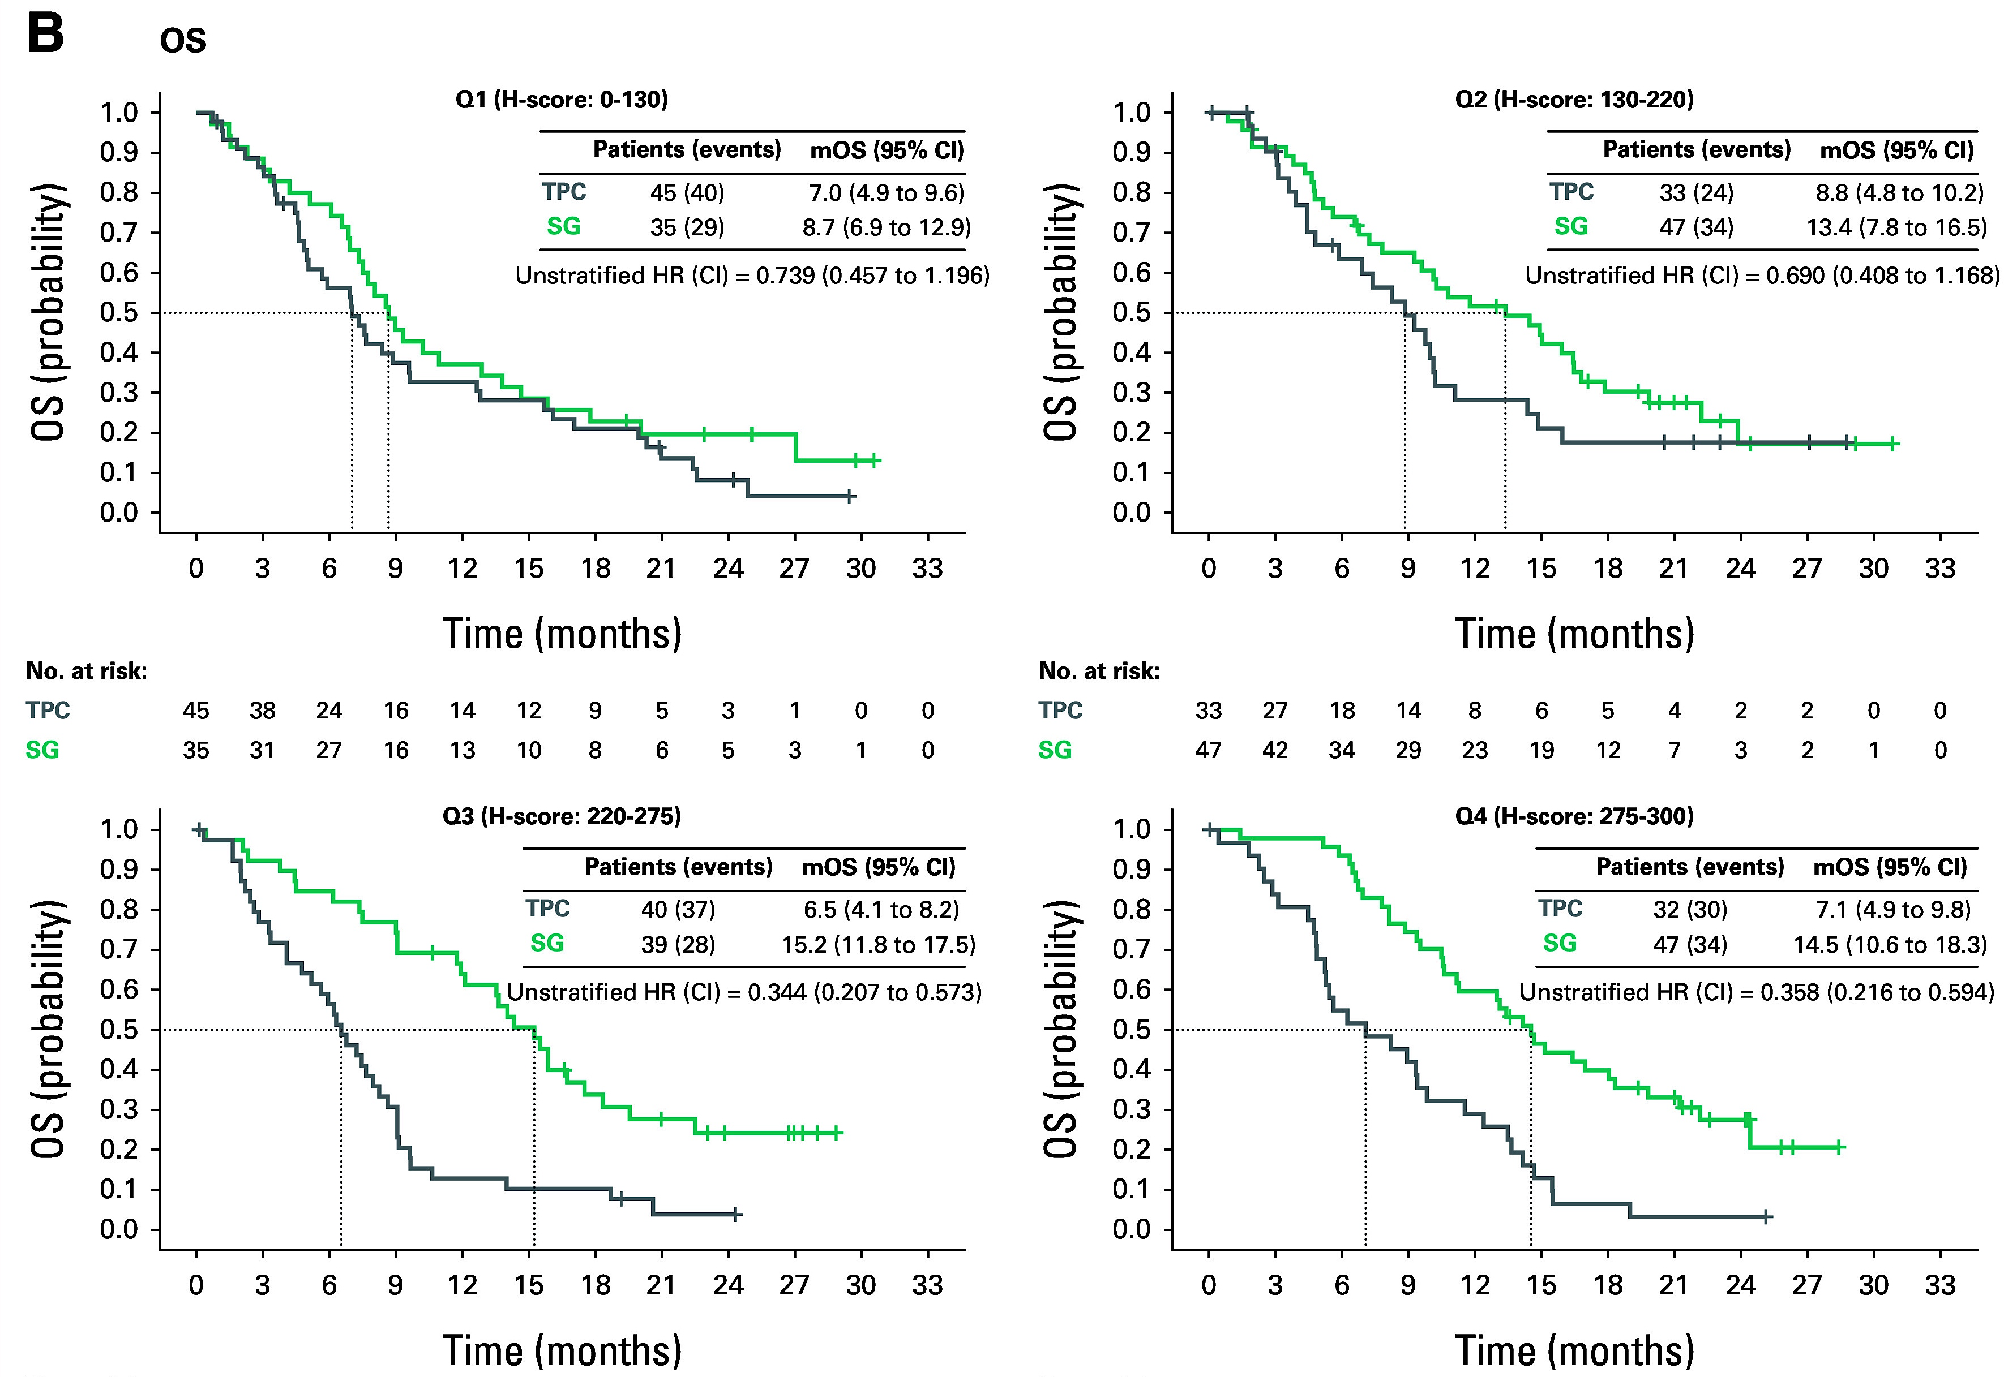
Phase III ASCENT: OS by TROP2 Expression
Bardia A et al. J Clin Oncol 2024.

Slide 60
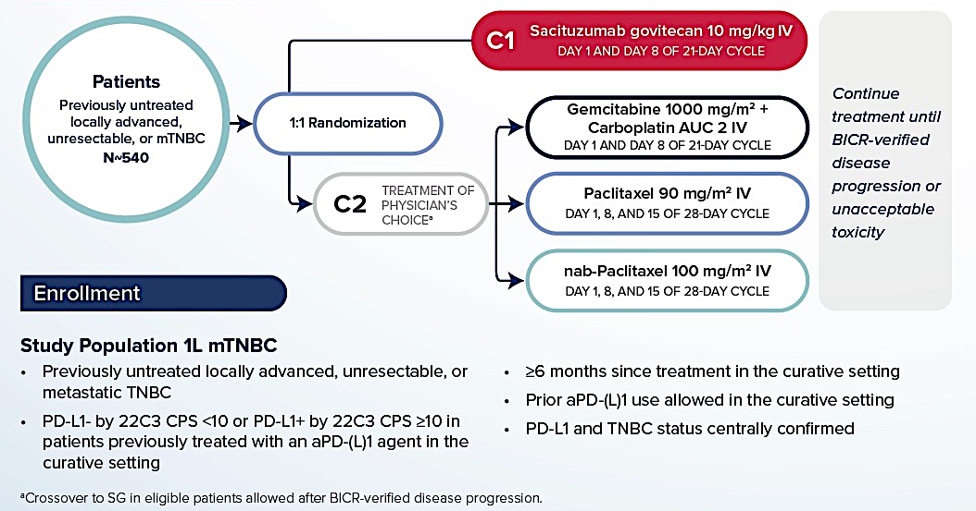
Phase III ASCENT-03 Study Design
www.clinicaltrials.gov. NCT05382299. Accessed August 2025.

Slide 61
ASCENT-03: First-Line Sacituzumab Govitecan Demonstrates Highly Statistically Significant and Clinically Meaningful Improvement in PFS for Patients with mTNBC Who Are Not Candidates for Checkpoint Inhibitors
Press Release: May 23, 2025
“[The manufacturer] announced positive topline results from the Phase 3 ASCENT-03 study of sacituzumab govitecan-hziy. The study met its primary endpoint, demonstrating a highly statistically significant and clinically meaningful improvement in progression-free survival (PFS) compared to chemotherapy in patients with first-line metastatic triple-negative breast cancer (mTNBC) who are not candidates for PD-1/PD-L1 inhibitors, meaning they are PD-L1 negative or are ineligible to receive immunotherapy.
The safety profile of sacituzumab govitecan-hziy in the ASCENT-03 study was consistent with prior studies, and no new safety signals were identified in this patient population. Overall survival (OS) is a key secondary endpoint and was not mature at the time of PFS primary analysis. No OS detriment was observed.”
https://www.gilead.com/news/news-details/2025/ascent-03-trodelvy-demonstrates-highly-statistically-significant--clinically-meaningful-improvement-in-progression-free-survival-in-patients-with-first-line-metastatic-triple-negative-breast

Slide 62
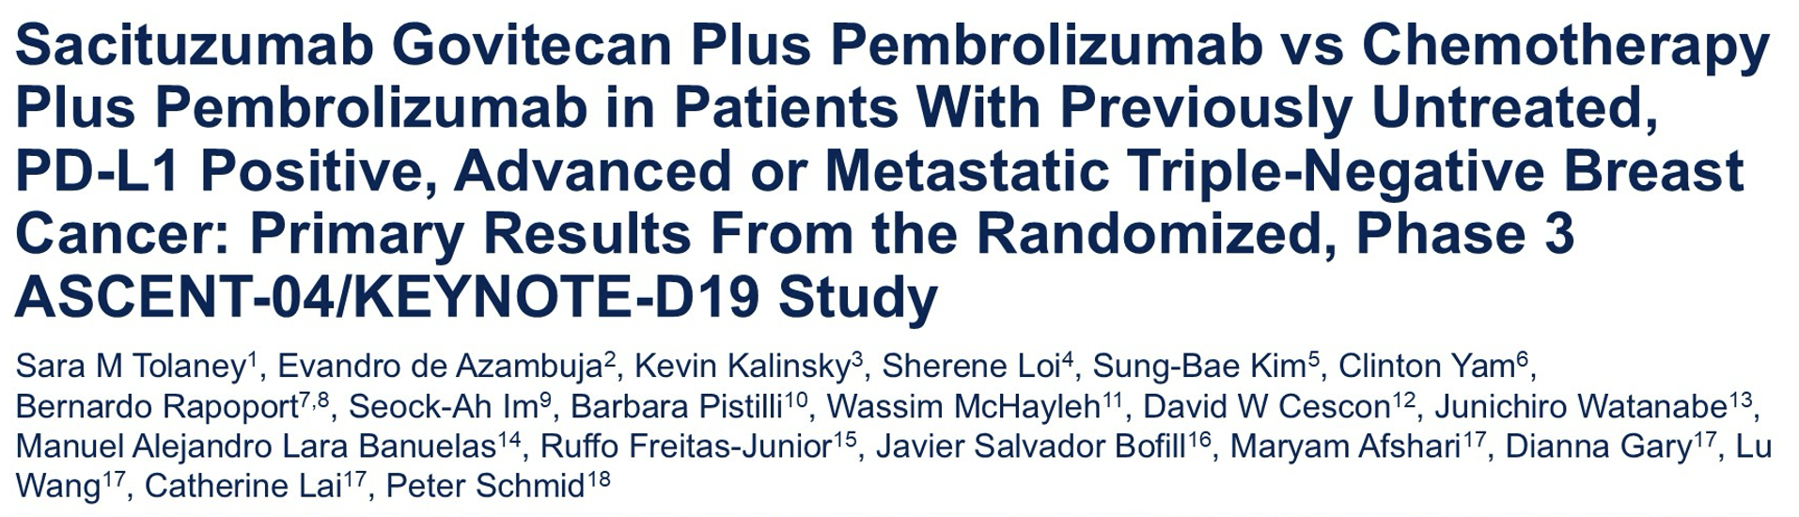
ASCO 2025;Abstract LBA109.

Slide 63
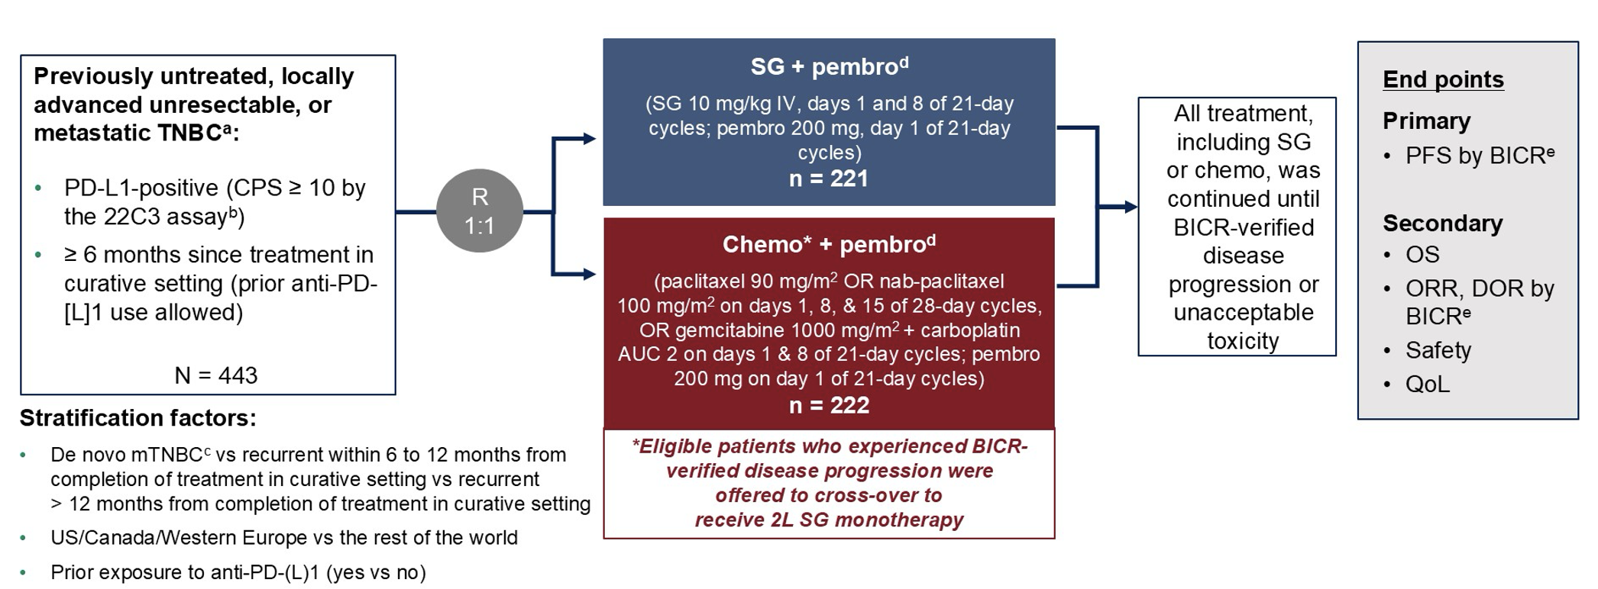
Phase III ASCENT-04/KEYNOTE-D19 Study Design
SG = sacituzumb govitecan; pembro = pembrolizumab
Tolaney SM et al. ASCO 2025;Abstract LBA109.

Slide 64
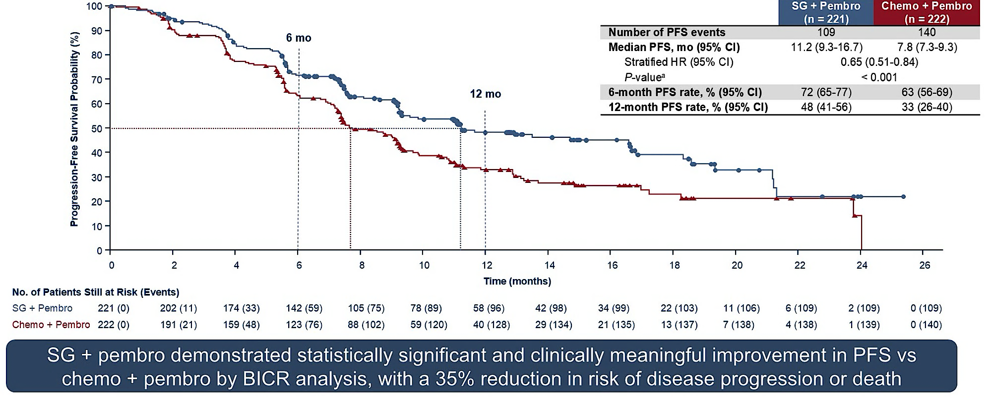
Phase III ASCENT-04/KEYNOTE-D19: Progression-Free Survival by BICR
BICR = blinded independent central review
Tolaney SM et al. ASCO 2025;Abstract LBA109.

Slide 65
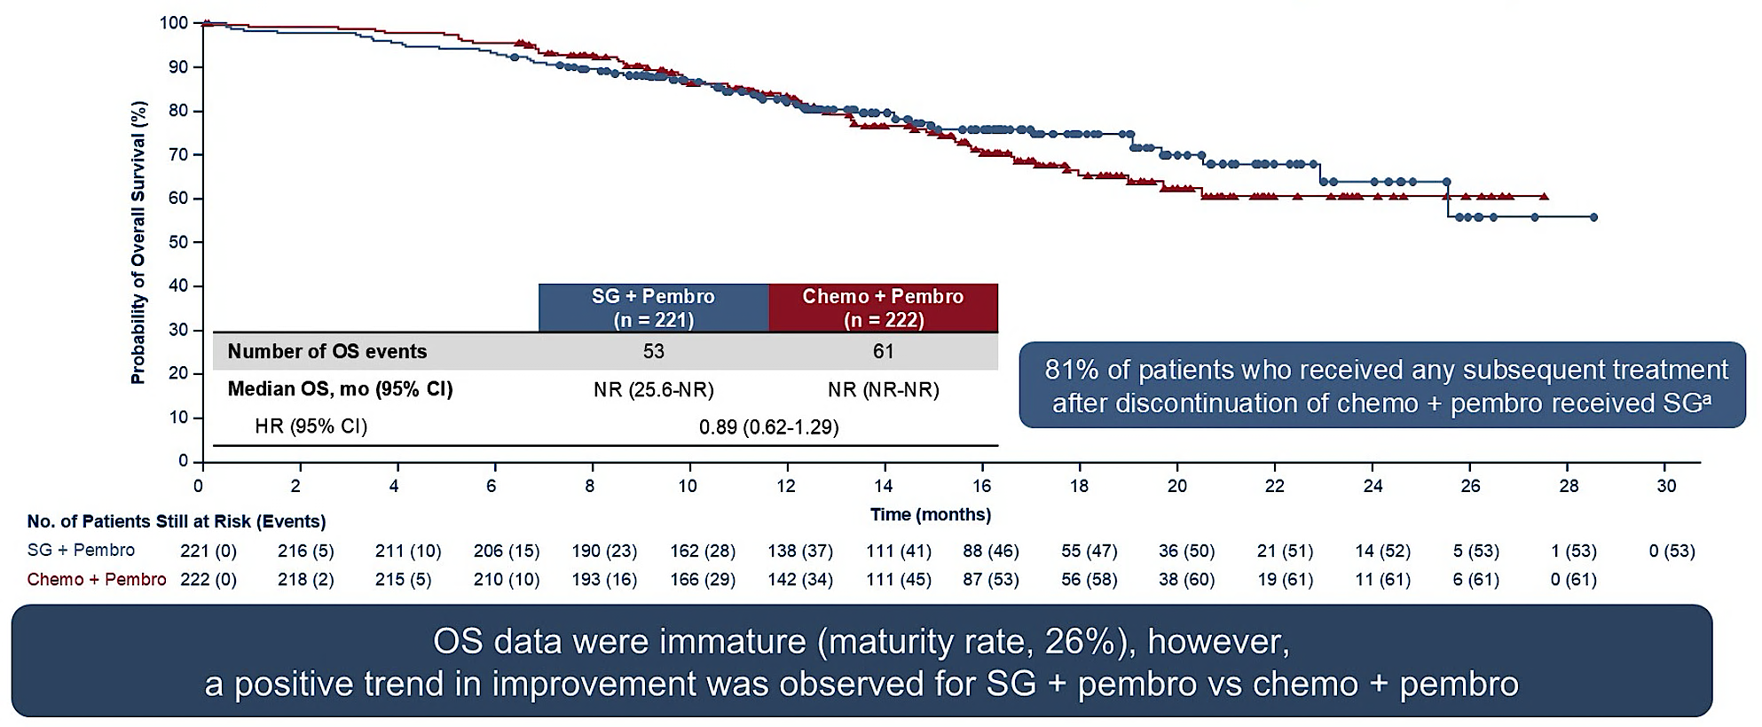
Phase III ASCENT-04/KEYNOTE-D19: Descriptive Overall Survival at Primary Analysis
Tolaney SM et al. ASCO 2025;Abstract LBA109.

Slide 66
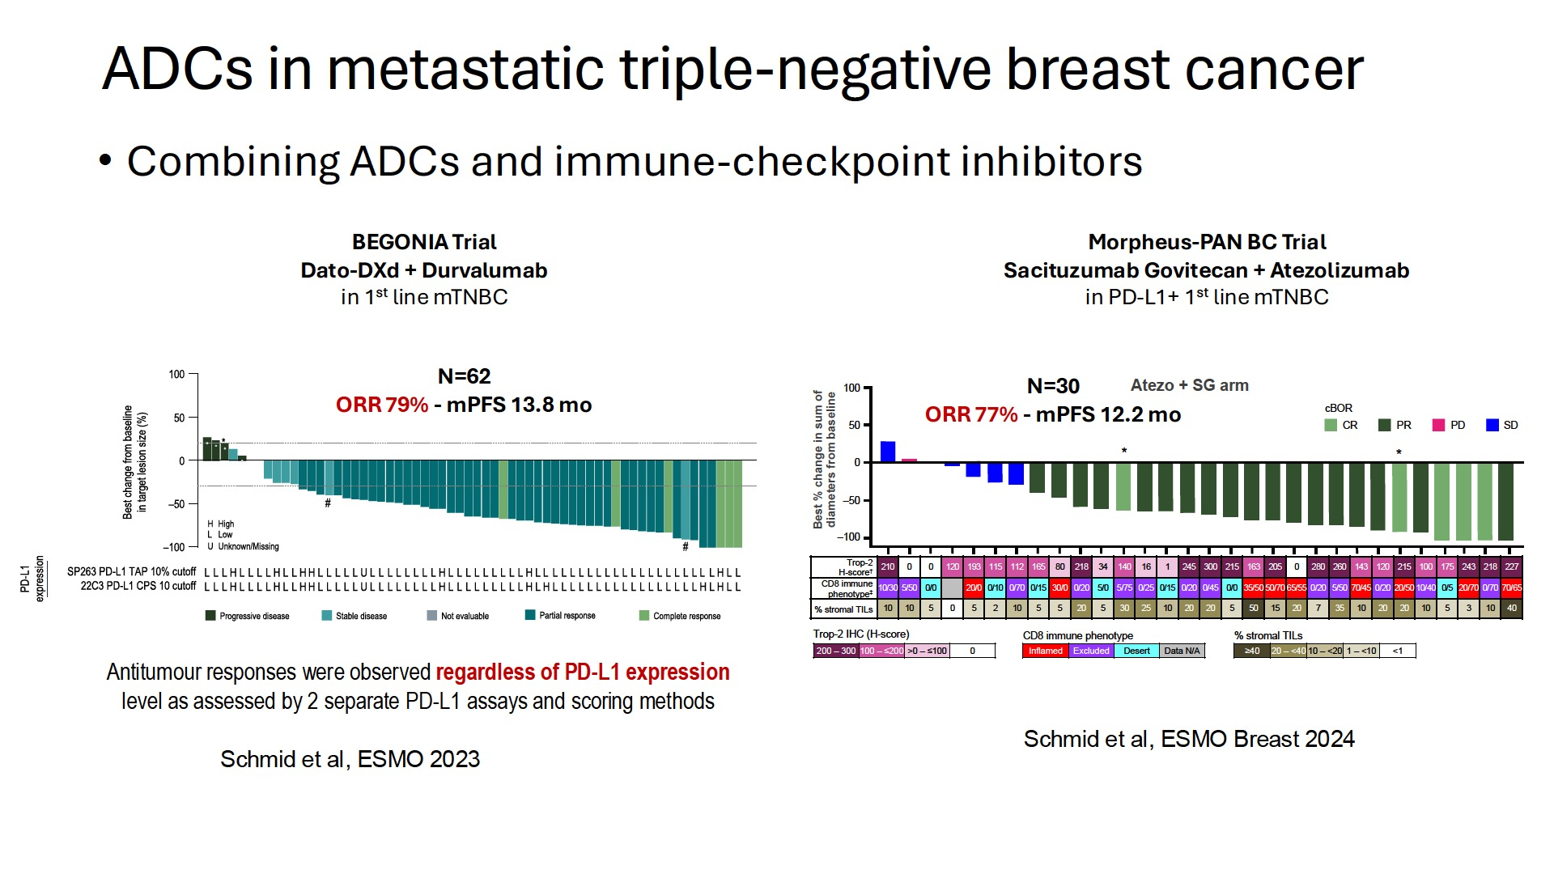
ADCs + IO for mTNBC
Courtesy of Rebecca A Dent, MD, MSc

Slide 67
Agenda
Introduction: Legendary Figures in Breast Cancer Research
Case 1: Dr Favaro – 82-year-old woman, a current smoker with PMH of myocardial infarction
and stroke, develops recurrent TNBC
Case 2: Dr Rudolph – 67-year-old woman with mTNBC (PD-L1 20%) receives chemotherapy/ pembrolizumab followed by sacituzumab govitecan
Case 3: Dr Zelkowitz – 68-year-old woman with localized TNBC develops myocarditis during neoadjuvant chemotherapy/pembrolizumab
Case 4: Dr Gupta – 64-year-old woman with recurrent ER-negative, HER2-low, PI3K-
mutant mTNBC
Case 5: Dr Lee – 63-year-old woman with recurrent TNBC confined to contralateral neck nodes
Case 6: Dr Rodriguez – 43-year-old woman with mTNBC s/p multiple lines of chemotherapy receives sacituzumab govitecan
Case 7: Dr Gupta – 76-year-old woman with ER-negative, HER2-low breast cancer develops
an isolated brain metastasis
Case 8: Dr Rudolph – 68-year-old woman with mTNBC experiences severe diarrhea with
sacituzumab govitecan

Slide 68
Case Presentation: 67-year-old woman with mTNBC (PD-L1 20%) receives chemotherapy/pembrolizumab followed by sacituzumab govitecan
Dr Priya Rudolph (Athens, Georgia)

Slide 69
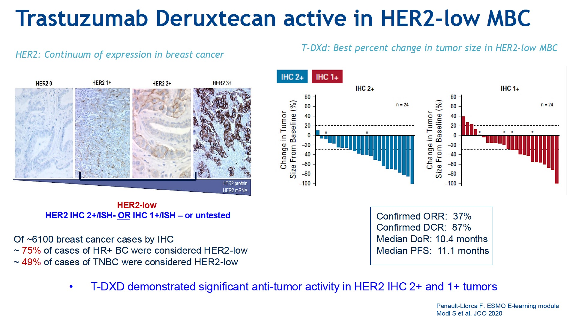
TDXD in HER2 low
Courtesy of Joyce O'Shaughnessy, MD

Slide 70
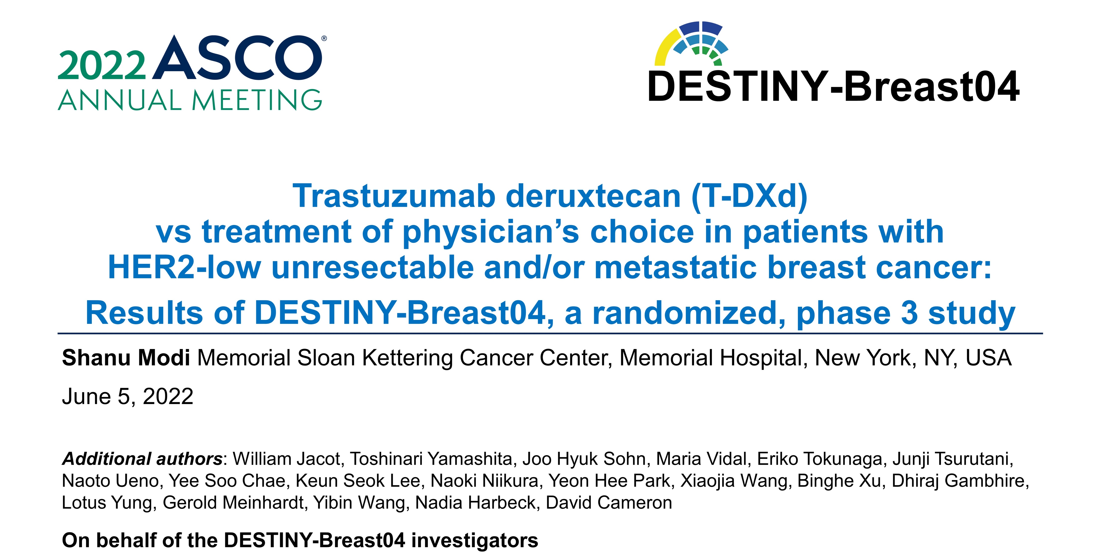
Abstract LBA3

Slide 71

Phase III DESTINY-Breast04: PFS
Modi S et al. ASCO 2022;Abstract LBA3.

Slide 72

Phase III DESTINY-Breast04: OS
Modi S et al. ASCO 2022;Abstract LBA3.

Slide 73

HER2-Ultralow Disease
Curigliano G et al. ASCO 2024;Abstract LBA1000.

Slide 74

Abstract LBA1000

Slide 75

Phase III DESTINY-Breast06 Study Design
Curigliano G et al. ASCO 2024;Abstract LBA1000.

Slide 76

Phase III DESTINY-Breast06: PFS in HER2-Low Disease (Primary Endpoint)
Curigliano G et al. ASCO 2024;Abstract LBA1000.

Slide 77

Phase III DESTINY-Breast06: Overall Survival (~40% Maturity)
Curigliano G et al. ASCO 2024;Abstract LBA1000.

Slide 78

Phase III DESTINY-Breast06: Survival in HER2-Ultralow Disease
Curigliano G et al. ASCO 2024;Abstract LBA1000.

Slide 79

Phase III DESTINY-Breast06: Activity by HER2 Expression
Curigliano G et al. ASCO 2024;Abstract LBA1000.

Slide 80
Agenda
Introduction: Legendary Figures in Breast Cancer Research
Case 1: Dr Favaro – 82-year-old woman, a current smoker with PMH of myocardial infarction
and stroke, develops recurrent TNBC
Case 2: Dr Rudolph – 67-year-old woman with mTNBC (PD-L1 20%) receives chemotherapy/ pembrolizumab followed by sacituzumab govitecan
Case 3: Dr Zelkowitz – 68-year-old woman with localized TNBC develops myocarditis during neoadjuvant chemotherapy/pembrolizumab
Case 4: Dr Gupta – 64-year-old woman with recurrent ER-negative, HER2-low, PI3K-
mutant mTNBC
Case 5: Dr Lee – 63-year-old woman with recurrent TNBC confined to contralateral neck nodes
Case 6: Dr Rodriguez – 43-year-old woman with mTNBC s/p multiple lines of chemotherapy receives sacituzumab govitecan
Case 7: Dr Gupta – 76-year-old woman with ER-negative, HER2-low breast cancer develops
an isolated brain metastasis
Case 8: Dr Rudolph – 68-year-old woman with mTNBC experiences severe diarrhea with
sacituzumab govitecan

Slide 81
Case Presentation: 68-year-old woman with localized TNBC develops myocarditis during neoadjuvant chemotherapy/pembrolizumab
Dr Richard Zelkowitz (Bridgeport, Connecticut)

Slide 82
Agenda
Introduction: Legendary Figures in Breast Cancer Research
Case 1: Dr Favaro – 82-year-old woman, a current smoker with PMH of myocardial infarction
and stroke, develops recurrent TNBC
Case 2: Dr Rudolph – 67-year-old woman with mTNBC (PD-L1 20%) receives chemotherapy/ pembrolizumab followed by sacituzumab govitecan
Case 3: Dr Zelkowitz – 68-year-old woman with localized TNBC develops myocarditis during neoadjuvant chemotherapy/pembrolizumab
Case 4: Dr Gupta – 64-year-old woman with recurrent ER-negative, HER2-low, PI3K-
mutant mTNBC
Case 5: Dr Lee – 63-year-old woman with recurrent TNBC confined to contralateral neck nodes
Case 6: Dr Rodriguez – 43-year-old woman with mTNBC s/p multiple lines of chemotherapy receives sacituzumab govitecan
Case 7: Dr Gupta – 76-year-old woman with ER-negative, HER2-low breast cancer develops
an isolated brain metastasis
Case 8: Dr Rudolph – 68-year-old woman with mTNBC experiences severe diarrhea with
sacituzumab govitecan

Slide 83
Case Presentation: 64-year-old woman with recurrent
ER-negative, HER2-low, PI3K-mutant mTNBC
Dr Ranju Gupta (Bethlehem, Pennsylvania)

Slide 84
Agenda
Introduction: Legendary Figures in Breast Cancer Research
Case 1: Dr Favaro – 82-year-old woman, a current smoker with PMH of myocardial infarction
and stroke, develops recurrent TNBC
Case 2: Dr Rudolph – 67-year-old woman with mTNBC (PD-L1 20%) receives chemotherapy/ pembrolizumab followed by sacituzumab govitecan
Case 3: Dr Zelkowitz – 68-year-old woman with localized TNBC develops myocarditis during neoadjuvant chemotherapy/pembrolizumab
Case 4: Dr Gupta – 64-year-old woman with recurrent ER-negative, HER2-low, PI3K-
mutant mTNBC
Case 5: Dr Lee – 63-year-old woman with recurrent TNBC confined to contralateral neck nodes
Case 6: Dr Rodriguez – 43-year-old woman with mTNBC s/p multiple lines of chemotherapy receives sacituzumab govitecan
Case 7: Dr Gupta – 76-year-old woman with ER-negative, HER2-low breast cancer develops
an isolated brain metastasis
Case 8: Dr Rudolph – 68-year-old woman with mTNBC experiences severe diarrhea with
sacituzumab govitecan

Slide 85
Case Presentation: 63-year-old woman with recurrent TNBC confined to contralateral neck nodes
Dr Eric Lee (Fountain Valley, California)

Slide 86
Agenda
Introduction: Legendary Figures in Breast Cancer Research
Case 1: Dr Favaro – 82-year-old woman, a current smoker with PMH of myocardial infarction
and stroke, develops recurrent TNBC
Case 2: Dr Rudolph – 67-year-old woman with mTNBC (PD-L1 20%) receives chemotherapy/ pembrolizumab followed by sacituzumab govitecan
Case 3: Dr Zelkowitz – 68-year-old woman with localized TNBC develops myocarditis during neoadjuvant chemotherapy/pembrolizumab
Case 4: Dr Gupta – 64-year-old woman with recurrent ER-negative, HER2-low, PI3K-
mutant mTNBC
Case 5: Dr Lee – 63-year-old woman with recurrent TNBC confined to contralateral neck nodes
Case 6: Dr Rodriguez – 43-year-old woman with mTNBC s/p multiple lines of chemotherapy receives sacituzumab govitecan
Case 7: Dr Gupta – 76-year-old woman with ER-negative, HER2-low breast cancer develops
an isolated brain metastasis
Case 8: Dr Rudolph – 68-year-old woman with mTNBC experiences severe diarrhea with
sacituzumab govitecan

Slide 87
Case Presentation: 43-year-old woman with mTNBC s/p multiple lines of chemotherapy receives sacituzumab govitecan
Dr Estelamari Rodriguez (Miami, Florida)

Slide 88

EClinicalMedicine 2025;85:103309. Published 2025 June 18.

Slide 89

Phase II PRIMED: Patients Experiencing Neutropenia and Diarrhea During the First 2 Treatment Cycles
Pérez-García JM et al. EClinicalMedicine 2025;85:103309. Published 2025 June 18.

Slide 90
Agenda
Introduction: Legendary Figures in Breast Cancer Research
Case 1: Dr Favaro – 82-year-old woman, a current smoker with PMH of myocardial infarction
and stroke, develops recurrent TNBC
Case 2: Dr Rudolph – 67-year-old woman with mTNBC (PD-L1 20%) receives chemotherapy/ pembrolizumab followed by sacituzumab govitecan
Case 3: Dr Zelkowitz – 68-year-old woman with localized TNBC develops myocarditis during neoadjuvant chemotherapy/pembrolizumab
Case 4: Dr Gupta – 64-year-old woman with recurrent ER-negative, HER2-low, PI3K-
mutant mTNBC
Case 5: Dr Lee – 63-year-old woman with recurrent TNBC confined to contralateral neck nodes
Case 6: Dr Rodriguez – 43-year-old woman with mTNBC s/p multiple lines of chemotherapy receives sacituzumab govitecan
Case 7: Dr Gupta – 76-year-old woman with ER-negative, HER2-low breast cancer develops
an isolated brain metastasis
Case 8: Dr Rudolph – 68-year-old woman with mTNBC experiences severe diarrhea with
sacituzumab govitecan

Slide 91
Case Presentation: 76-year-old woman with ER-negative, HER2-low breast cancer develops an isolated brain metastasis
Dr Ranju Gupta (Bethlehem, Pennsylvania)

Slide 92
Agenda
Introduction: Legendary Figures in Breast Cancer Research
Case 1: Dr Favaro – 82-year-old woman, a current smoker with PMH of myocardial infarction
and stroke, develops recurrent TNBC
Case 2: Dr Rudolph – 67-year-old woman with mTNBC (PD-L1 20%) receives chemotherapy/ pembrolizumab followed by sacituzumab govitecan
Case 3: Dr Zelkowitz – 68-year-old woman with localized TNBC develops myocarditis during neoadjuvant chemotherapy/pembrolizumab
Case 4: Dr Gupta – 64-year-old woman with recurrent ER-negative, HER2-low, PI3K-
mutant mTNBC
Case 5: Dr Lee – 63-year-old woman with recurrent TNBC confined to contralateral neck nodes
Case 6: Dr Rodriguez – 43-year-old woman with mTNBC s/p multiple lines of chemotherapy receives sacituzumab govitecan
Case 7: Dr Gupta – 76-year-old woman with ER-negative, HER2-low breast cancer develops
an isolated brain metastasis
Case 8: Dr Rudolph – 68-year-old woman with mTNBC experiences severe diarrhea with
sacituzumab govitecan

Slide 93
Case Presentation: 68-year-old woman with PD-L1-negative mTNBC experiences severe diarrhea with second-line sacituzumab govitecan
Dr Priya Rudolph (Athens, Georgia)

Slide 94
FDA Approves Datopotamab Deruxtecan-dlnk for Unresectable or Metastatic HR-Positive, HER2-Negative Breast Cancer
Press Release: January 17, 2025
“On January 17, 2025, the Food and Drug Administration approved datopotamab deruxtecan-dlnk,
a Trop-2-directed antibody and topoisomerase inhibitor conjugate, for adult patients with unresectable or metastatic, hormone receptor (HR)-positive, human epidermal growth factor receptor 2 (HER2)-negative (IHC 0, IHC1+ or IHC2+/ISH-) breast cancer who have received prior endocrine-based therapy and chemotherapy for unresectable or metastatic disease.
Efficacy was evaluated in TROPION-Breast01 (NCT05104866), a multicenter, open-label, randomized trial. Patients must have experienced disease progression, been deemed unsuitable for further endocrine therapy, and have received one or two lines of prior chemotherapy for unresectable or metastatic disease. Patients were excluded for a history of ILD/pneumonitis requiring steroids, ongoing ILD/pneumonitis, clinically active brain metastases, or clinically significant corneal disease. Patients also were excluded for ECOG performance status >1.”
https://www.fda.gov/drugs/resources-information-approved-drugs/fda-approves-datopotamab-deruxtecan-dlnk-unresectable-or-metastatic-hr-positive-her2-negative-breast

Slide 95

Phase III TROPION-Breast01 Trial: Progression-Free Survival (PFS)
PFS
Bardia A et al. J Clin Oncol 2025;43(3):285-96.
ICC = investigator's choice of chemotherapy

Slide 96

TROPION_breast02 and 05
Courtesy of Sara M Tolaney, MD, MPH

Slide 97

Sac-tmt
Courtesy of Sara M Tolaney, MD, MPH

Slide 98


Slide 99

Phase III OptiTROP-Breast01: Final PFS Analysis (by BICR)
Yin Y et al. Nat Med 2025;31(6):1969-75.

Slide 100

ASCO 2025;Abstract 1019.

Slide 101

Phase II OptiTROP-Breast05: Responses
ORR = objective response rate; DCR = disease control rate
Yin Y et al. ASCO 2025;Abstract 1019.

Slide 102
Contributing General Medical Oncologists
Justin Favaro, MD, PhD
Oncology Specialists of Charlotte
Charlotte, North Carolina
Estelamari Rodriguez, MD, MPH
Sylvester Comprehensive
Cancer Center
Miami, Florida
Ranju Gupta, MD
Lehigh Valley Topper Cancer Institute
Bethlehem, Pennsylvania
Priya Rudolph, MD, PhD
Georgia Cancer Specialists
Northside Hospital Cancer Institute
Athens, Georgia
Eric H Lee, MD, PhD
Compassionate Cancer Care Medical Group
Fountain Valley, California
Richard Zelkowitz, MD
Hartford HealthCare Cancer Institute
Bridgeport, Connecticut

Slide 103
Consensus or Controversy? Clinical Investigators Provide Perspectives on the Current and Future Care of Patients with Relapsed/Refractory Multiple Myeloma
Part 1 of a 2-Part CME/MOC-, NCPD- and ACPE-Accredited Satellite Symposium Series During the Society of Hematologic Oncology 2025 Annual Meeting
Thursday, September 4, 2025
6:42 PM – 7:42 PM CT
Faculty
Meletios-Athanasios (Thanos) C Dimopoulos, MD
Hans Lee, MD
Noopur Raje, MD
Moderator
Joseph Mikhael, MD, MEd

Slide 104
Thank you for joining us!
Please take a moment to complete the survey currently up on Zoom. Your feedback is very important to us.
The survey will remain open for
5 minutes after the meeting ends.
Information on how to obtain CME, ABIM MOC and ABS credit is provided in the Zoom chat room.
Attendees will also receive an email in 1 to 3 business days with these instructions.

