Slide 1
Current and Future Integration of Antibody-Drug Conjugates into the Management of Metastatic Breast Cancer
A CME/MOC-Accredited Live Webinar
Tuesday, September 30, 2025 5:00 PM – 6:00 PM ET
Faculty
Aditya Bardia, MD, MPH
Adam M Brufsky, MD, PhD
Moderator
Neil Love, MD

Slide 2

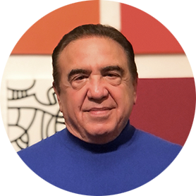
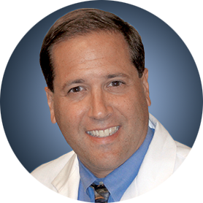
Faculty
Aditya Bardia, MD, MPH
Program Director, Breast Medical Oncology
Assistant Chief (Translational Research)
Division of Hematology-Oncology
Director of Translational Research Integration
UCLA Health Jonsson Comprehensive Cancer Center
Professor of Medicine, Geffen School of Medicine
University of California Los Angeles
Los Angeles, California
MODERATOR
Neil Love, MD Research To Practice Miami, Florida
Adam M Brufsky, MD, PhD
Professor of Medicine
UPMC Hillman Cancer Center
Department of Medicine
University of Pittsburgh
Pittsburgh, Pennsylvania

Slide 3
Commercial Support
This activity is supported by an educational grant from Gilead Sciences Inc.

Slide 4
Dr Love — Disclosures
Dr Love is president and CEO of Research To Practice. Research To Practice receives funds in the form of educational grants to develop CME activities from the following companies: Aadi Bioscience, AbbVie Inc, ADC Therapeutics, Alexion Pharmaceuticals, Amgen Inc, Array BioPharma Inc, a subsidiary of Pfizer Inc, Arvinas, Astellas, AstraZeneca Pharmaceuticals LP, Aveo Pharmaceuticals, Bayer HealthCare Pharmaceuticals, BeOne, Black Diamond Therapeutics Inc, Blueprint Medicines, Boehringer Ingelheim Pharmaceuticals Inc, Bristol Myers Squibb, Clovis Oncology, Coherus BioSciences, Corcept Therapeutics Inc, CTI BioPharma, a Sobi Company, Daiichi Sankyo Inc, Eisai Inc, Elevation Oncology Inc, Exact Sciences Corporation, Exelixis Inc, Genentech, a member of the Roche Group, Genmab US Inc, Geron Corporation, Gilead Sciences Inc, GSK, Helsinn Therapeutics (US) Inc, Hologic Inc, ImmunoGen Inc, Incyte Corporation, Ipsen Biopharmaceuticals Inc, Jazz Pharmaceuticals Inc, Johnson & Johnson, Karyopharm Therapeutics, Kite, A Gilead Company, Kura Oncology, Legend Biotech, Lilly, MEI Pharma Inc, Merck, Mersana Therapeutics Inc, Mirati Therapeutics Inc, Mural Oncology Inc, Natera Inc, Novartis, Novartis Pharmaceuticals Corporation on behalf of Advanced Accelerator Applications, Novocure Inc, Nuvalent, Pfizer Inc, Pharmacyclics LLC, an AbbVie Company, Puma Biotechnology Inc, Regeneron Pharmaceuticals Inc, Rigel Pharmaceuticals Inc, R-Pharm US, Sanofi, Seagen Inc, Servier Pharmaceuticals LLC, SpringWorks Therapeutics Inc, Stemline Therapeutics Inc, Sumitomo Pharma America, Syndax Pharmaceuticals, Taiho Oncology Inc, Takeda Pharmaceuticals USA Inc, TerSera Therapeutics LLC, and Tesaro, A GSK Company.

Slide 5
Research To Practice CME Planning Committee Members, Staff and Reviewers
Planners, scientific staff and independent reviewers for Research To Practice have no relevant conflicts of interest to disclose.

Slide 6
Dr Bardia — Disclosures
Consulting Agreements | Alyssum Therapeutics, AstraZeneca Pharmaceuticals LP, Daiichi Sankyo Inc, Genentech, a member of the Roche Group, Gilead Sciences Inc, Lilly, Menarini Group, Merck, Novartis, Pfizer Inc
Contracted Research | AstraZeneca Pharmaceuticals LP, Daiichi Sankyo Inc, Genentech, a member of the Roche Group, Gilead Sciences Inc, Lilly, Menarini Group, Merck, Novartis, OnKure Therapeutics, Pfizer Inc

Slide 7
Dr Brufsky — Disclosures
Consulting Agreements | Agendia Inc, AstraZeneca Pharmaceuticals LP, BriaCell, Celcuity, Daiichi Sankyo Inc, Genentech, a member of the Roche Group, Gilead Sciences Inc, Lilly, Merck, Myriad Genetic Laboratories Inc, Novartis, Pfizer Inc, Puma Biotechnology Inc, Sanofi

Slide 8
This educational activity contains discussion of non-FDA-approved uses of agents and regimens. Please refer to official prescribing information for each product for approved indications.

Slide 9
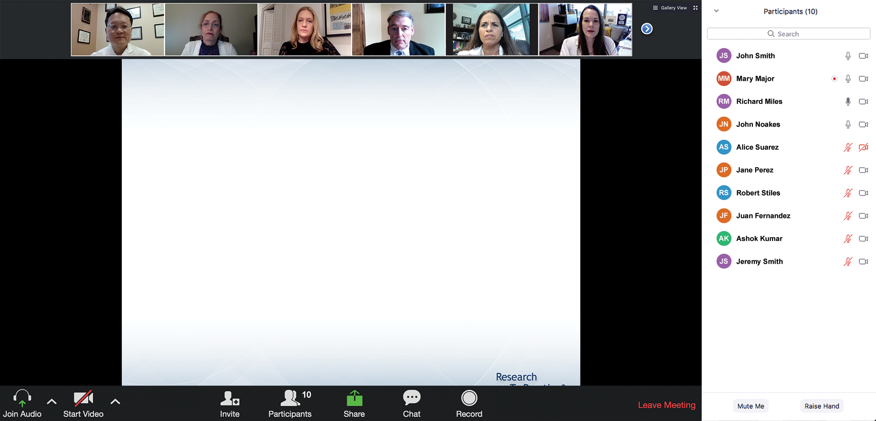

We Encourage Clinicians in Practice to Submit Questions
Feel free to submit questions now before the program begins and throughout the program.

Slide 10
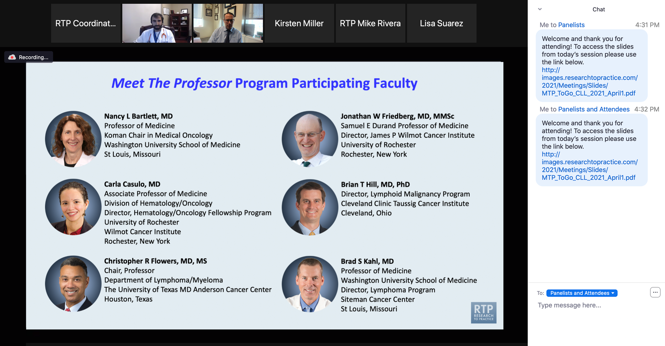
Familiarizing Yourself with the Zoom Interface
Expand chat submission box
Drag the white line above the submission box up to create more space for your message.

Slide 11
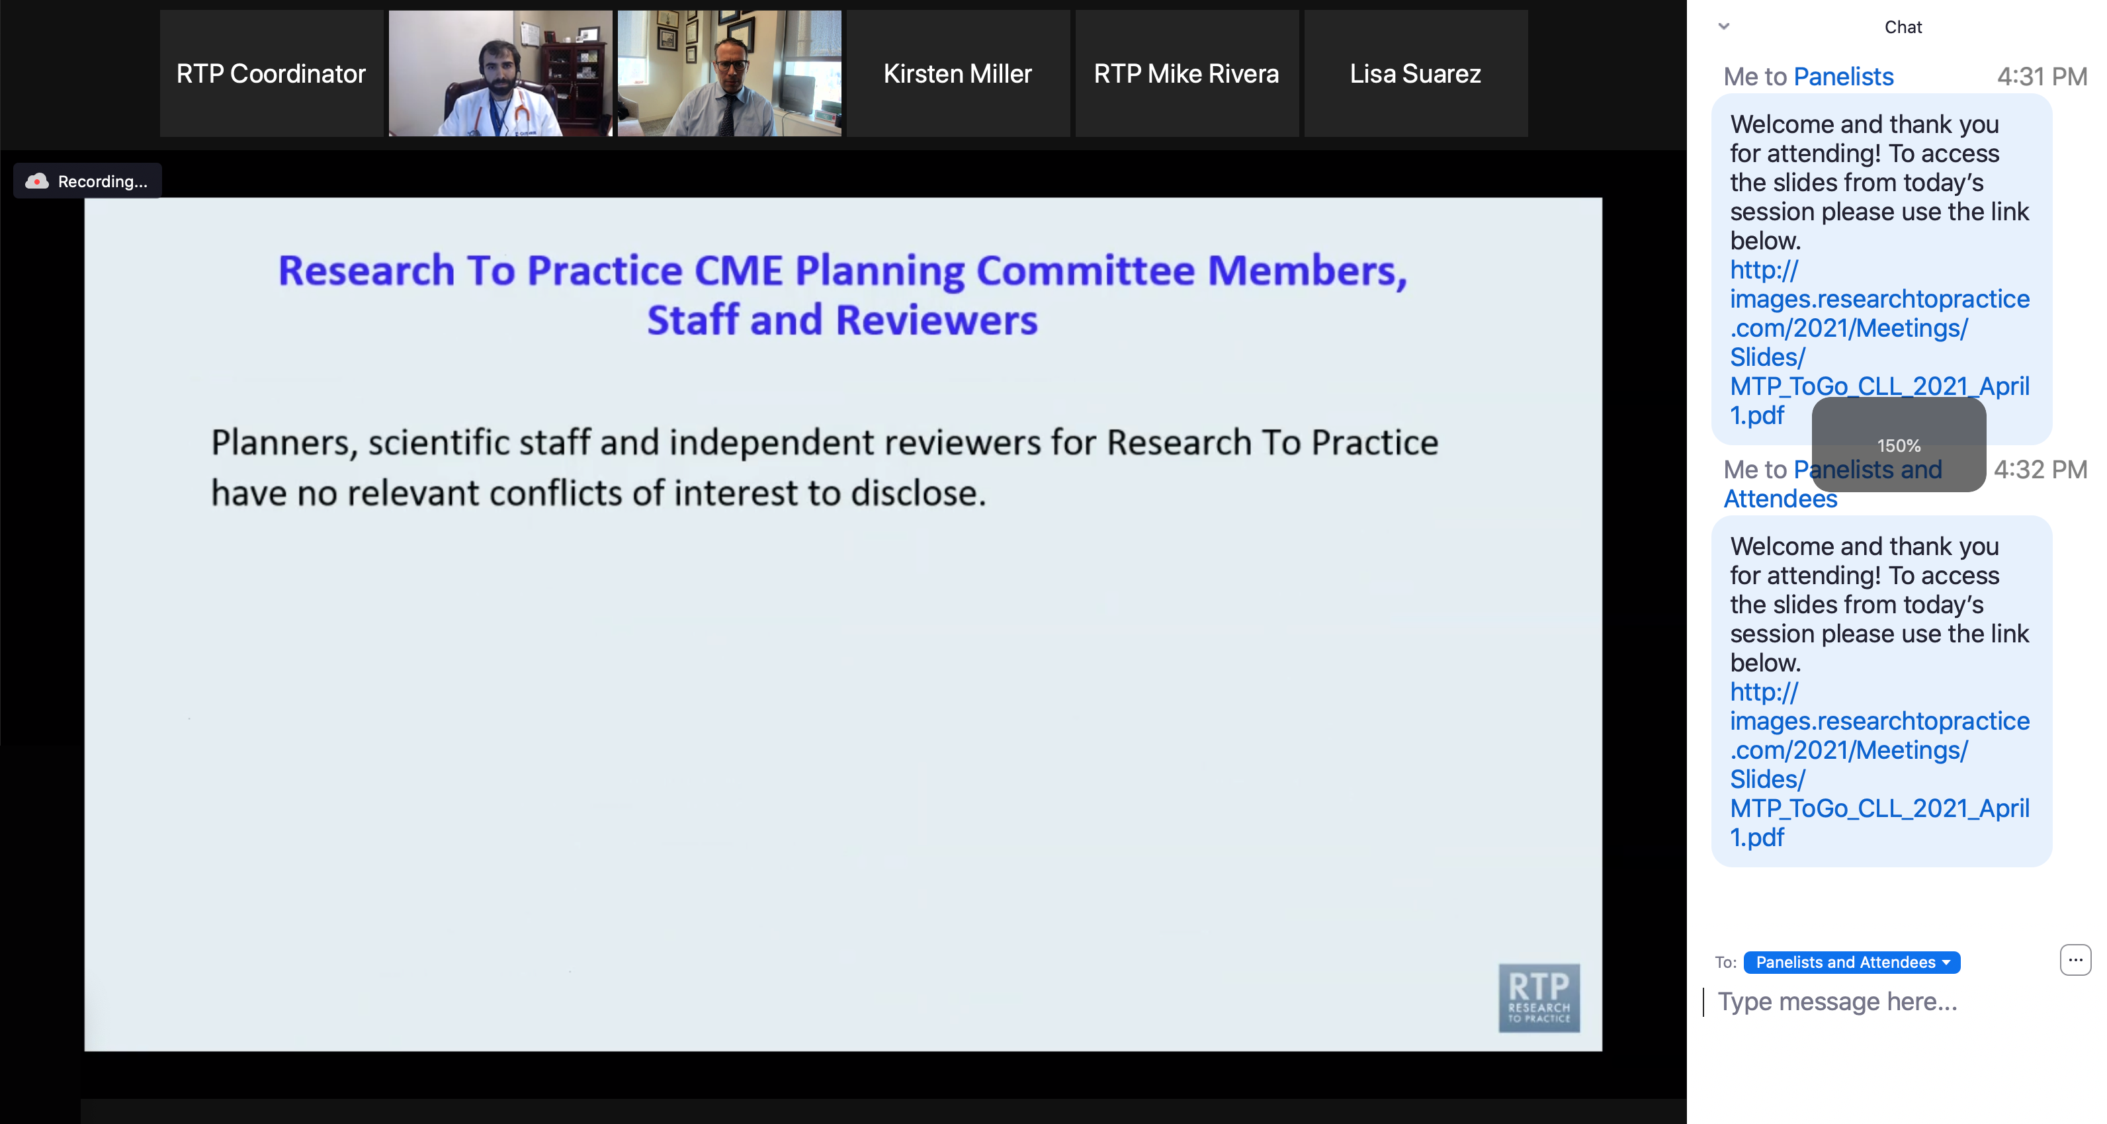
Familiarizing Yourself with the Zoom Interface
Increase chat font size
Press Command (for Mac) or Control (for PC) and the + symbol. You may do this as many times as you need for readability.

Slide 12
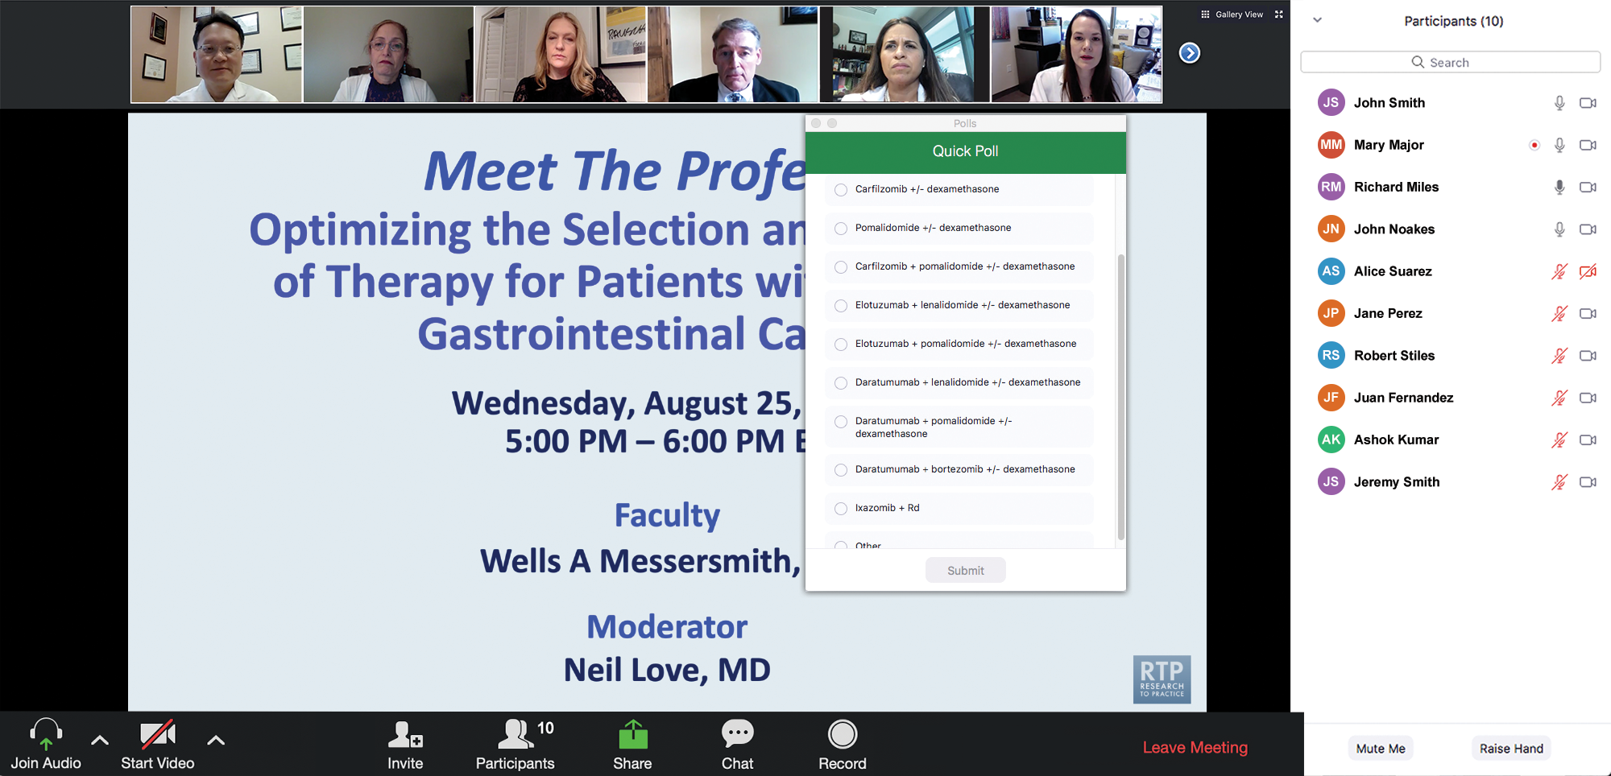
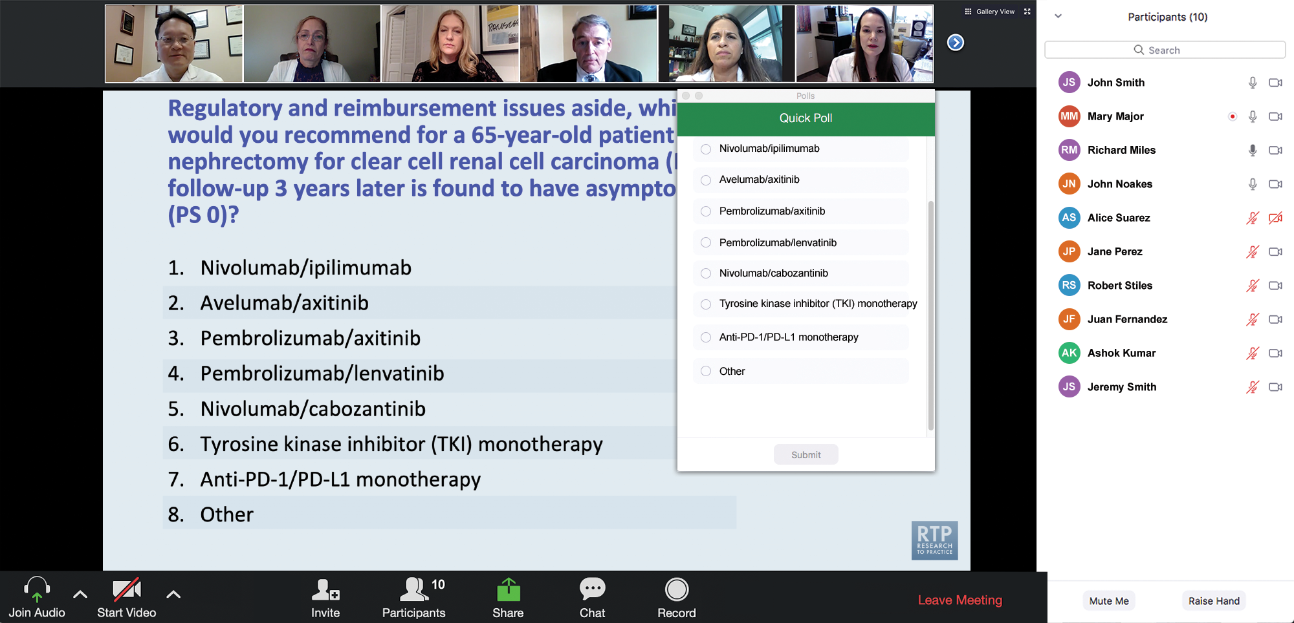
Clinicians in the Audience, Please Complete the Pre- and Postmeeting Surveys
Quick Survey
Quick Poll

Slide 13
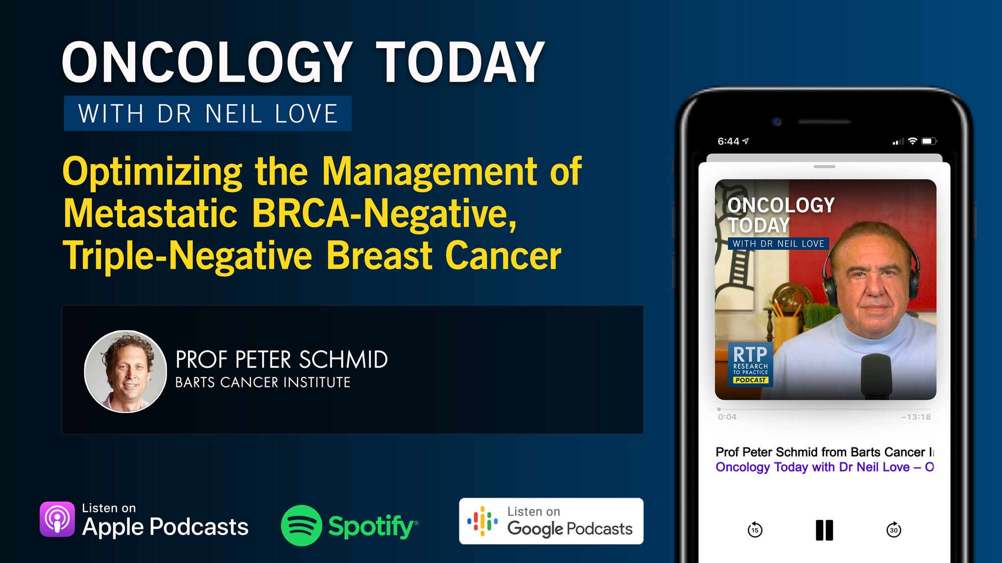

Slide 14
Data + Perspectives: Clinical Investigators Explore the Application of Recent Datasets in Current Oncology Care
A Multitumor Symposium in Partnership with Florida Cancer Specialists & Research Institute
Saturday, October 11, 2025 7:15 AM – 12:30 PM ET
The Ritz-Carlton Orlando, Grande Lakes | Orlando, Florida
Faculty
Emmanuel S Antonarakis, MD Harold J Burstein, MD, PhD
Matthew P Goetz, MD
Christopher Lieu, MD Matthew Lunning, DO
Heather McArthur, MD, MPH, FASCO Rita Nanda, MD
Matthew R Smith, MD, PhD
Sonali M Smith, MD
John Strickler, MD
Moderator
Neil Love, MD

Slide 15
Practical Perspectives: Experts Review Actual Cases of Patients with Endometrial Cancer
A CME/MOC-Accredited Live Webinar
Wednesday, October 15, 2025 5:00 PM – 6:00 PM ET
Faculty
Kathleen N Moore, MD, MS
Matthew A Powell, MD
Moderator
Neil Love, MD

Slide 16
Practical Perspectives: Experts Review Actual Cases of Patients with HER2-Positive Gastrointestinal Cancers
A CME/MOC-Accredited Live Webinar
Tuesday, October 21, 2025​ 5:00 PM – 6:00 PM ET
Faculty
Tanios Bekaii-Saab, MD
Kristen K Ciombor, MD, MSCI
Moderator
Neil Love, MD

Slide 17
Cancer Q&A: Understanding the Role and Reality of CAR (Chimeric Antigen Receptor) T-Cell Therapy for Non-Hodgkin Lymphoma
A Webinar Series for Clinicians and Patients, Developed in Partnership with CancerCare®
Patients
Clinicians
Wednesday, October 22, 2025
6:00 PM – 7:00 PM ET
Wednesday, November 12, 2025
5:00 PM – 6:00 PM ET
Faculty
Jeremy S Abramson, MD, MMSc
Loretta J Nastoupil, MD
Moderator
Neil Love, MD

Slide 18
Addressing Current Knowledge and Practice Gaps in the Community — Optimizing the Use of Oral Selective Estrogen Receptor Degraders for Metastatic Breast Cancer, Part 2
A CME/MOC-Accredited Live Webinar
Wednesday, October 29, 2025 5:00 PM – 6:00 PM ET
Faculty
Rinath M Jeselsohn, MD
Joyce O’Shaughnessy, MD
Moderator
Neil Love, MD

Slide 19
Integrating New Advances into the Care of Patients with Cancer A Multitumor Symposium in Partnership with the American Oncology Network
Join Us In Person or Virtually
Saturday, November 8, 2025
Lung Cancer
Faculty
Justin F Gainor, MD
Corey J Langer, MD
Chronic Lymphocytic Leukemia
Faculty
Kerry A Rogers, MD
Moderator Stephen "Fred" Divers, MD

Slide 20
Integrating New Advances into the Care of Patients with Cancer A Multitumor Symposium in Partnership with the American Oncology Network
Join Us In Person or Virtually
Saturday, November 8, 2025
Ovarian Cancer
Faculty
To be announced
Gastroesophageal Cancers
Faculty
Manish A Shah, MD
Moderator Stephen "Fred" Divers, MD

Slide 21
Prevention and Management of Toxicities Associated with Antibody-Drug Conjugates in the Treatment of Metastatic Breast Cancer
A CME/MOC-Accredited Live Webinar
Wednesday, November 19, 2025 5:00 PM – 6:00 PM ET
Faculty
Lisa A Carey, MD, ScM, FASCO
Rita Nanda, MD
Moderator
Neil Love, MD

Slide 22
Exciting CME Events You Do Not Want to Miss
A Friday Satellite Symposium Series Preceding the 67th ASH Annual Meeting
Friday, December 5, 2025
Acute Myeloid Leukemia
7:30 AM – 9:30 AM ET
Myelofibrosis
3:15 PM – 5:15 PM ET
Chronic Lymphocytic Leukemia
11:30 AM – 1:30 PM ET
Follicular Lymphoma and
Diffuse Large B-Cell Lymphoma
7:00 PM – 9:00 PM ET

Slide 23
Cases from the Community: Investigators Discuss the Optimal Management of Breast Cancer
A 3-Part CME Satellite Symposium Series
Antibody-Drug Conjugates for
Metastatic Breast Cancer
Tuesday, December 9, 2025
7:00 PM – 8:30 PM CT
HER2-Positive Breast Cancer
Wednesday, December 10, 2025
7:00 PM – 9:00 PM CT
Endocrine-Based Therapy
Thursday, December 11, 2025
7:00 PM – 9:00 PM CT
Moderator
Neil Love, MD

Slide 24
Optimizing Treatment for Patients with Relapsed/Refractory Chronic Lymphocytic Leukemia
A CME/MOC-Accredited Interactive Grand Rounds Series
October 2025 to March 2026
Steering Committee
Catherine C Coombs, MD
Matthew S Davids, MD, MMSc
Bita Fakhri, MD, MPH
Nicole Lamanna, MD
Jeff Sharman, MD
Jennifer Woyach, MD
Host a 1-hour session at your institution: Email Meetings@ResearchToPractice.com or call (800) 233-6153

Slide 25
Thank you for joining us! Please take a moment to complete the survey currently up on Zoom. Your feedback is very important to us. Information on how to obtain CME, ABIM MOC and ABS credit will be provided at the conclusion of the activity in the Zoom chat room. Attendees will also receive an email in 1 to 3 business days with these instructions.

Slide 26
Current and Future Integration of Antibody-Drug Conjugates into the Management of Metastatic Breast Cancer
A CME/MOC-Accredited Live Webinar
Tuesday, September 30, 2025 5:00 PM – 6:00 PM ET
Faculty
Aditya Bardia, MD, MPH
Adam M Brufsky, MD, PhD
Moderator
Neil Love, MD

Slide 27
Faculty
Aditya Bardia, MD, MPH
Program Director, Breast Medical Oncology
Assistant Chief (Translational Research)
Division of Hematology-Oncology
Director of Translational Research Integration
UCLA Health Jonsson Comprehensive Cancer Center
Professor of Medicine, Geffen School of Medicine
University of California Los Angeles
Los Angeles, California
MODERATOR
Neil Love, MD Research To Practice Miami, Florida
Adam M Brufsky, MD, PhD
Professor of Medicine
UPMC Hillman Cancer Center
Department of Medicine
University of Pittsburgh
Pittsburgh, Pennsylvania

Slide 28
We Encourage Clinicians in Practice to Submit Questions
Feel free to submit questions now before the program begins and throughout the program.

Slide 29
Clinicians in the Audience, Please Complete the Pre- and Postmeeting Surveys
Quick Survey
Quick Poll

Slide 31
Data + Perspectives: Clinical Investigators Explore the Application of Recent Datasets in Current Oncology Care
A Multitumor Symposium in Partnership with Florida Cancer Specialists & Research Institute
Saturday, October 11, 2025 7:15 AM – 12:30 PM ET
The Ritz-Carlton Orlando, Grande Lakes | Orlando, Florida
Faculty
Emmanuel S Antonarakis, MD Harold J Burstein, MD, PhD
Matthew P Goetz, MD
Christopher Lieu, MD Matthew Lunning, DO
Heather McArthur, MD, MPH, FASCO Rita Nanda, MD
Matthew R Smith, MD, PhD
Sonali M Smith, MD
John Strickler, MD
Moderator
Neil Love, MD

Slide 32
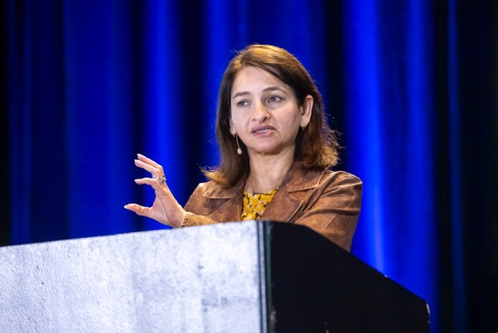
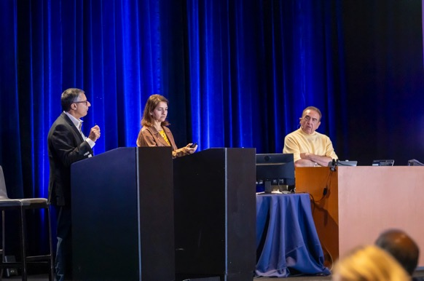
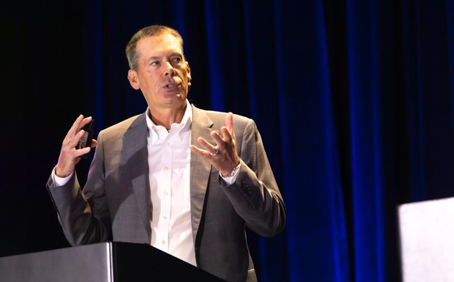
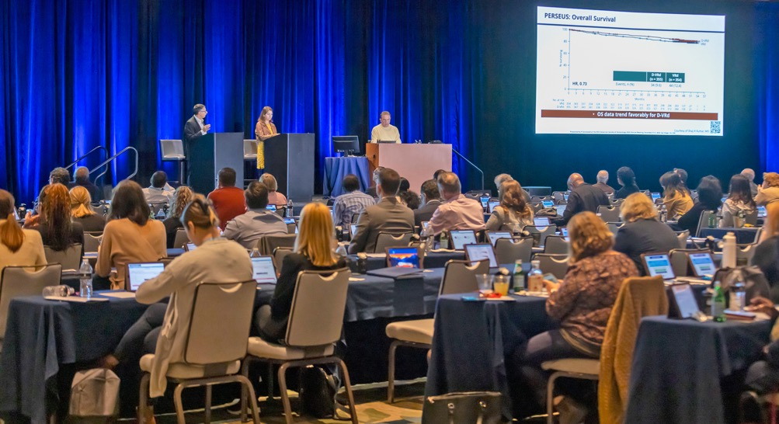
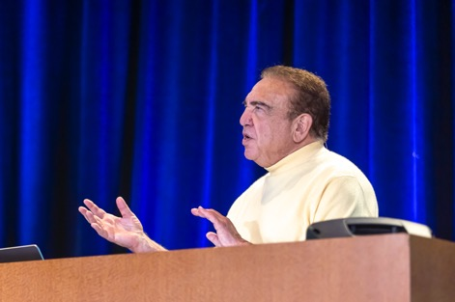
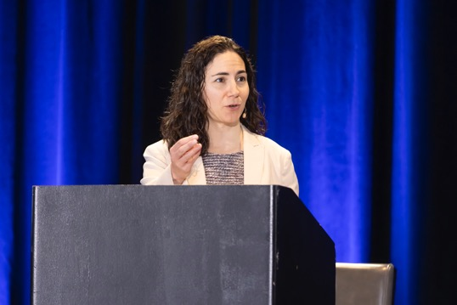
Florida Cancer Specialists/Research To Practice CME Annual Retreat Program 2005 to 2025

Slide 33
Data + Perspectives: Clinical Investigators Explore the Application of Recent Datasets in Current Oncology Care Agenda
7:15 AM – 9:15 AM — Breast Cancer
Localized Hormone Receptor (HR)-Positive Breast Cancer; Initial Therapy for Metastatic Disease
Therapeutic Options for Relapsed/Refractory HR-Positive Metastatic Breast Cancer
Management of HER2-Positive Breast Cancer
Treatment Approaches for Triple-Negative Breast Cancer
9:15 AM – 9:30 AM — Break
9:30 AM – 10:30 AM — Prostate Cancer
• Optimizing the Role of Hormonal Therapy in the Care of Patients with Prostate Cancer
• Other Available and Emerging Therapeutic Approaches
10:30 AM – 11:30 AM — Colorectal Cancer (CRC)
• Current and Future Role of Immune Checkpoint Inhibitors in the Management of CRC
• Other Biomarker-Based Strategies for Patients with CRC
11:30 AM – 12:30 PM — Diffuse Large B-Cell Lymphoma (DLBCL) and Follicular Lymphoma (FL)
• Available and Emerging Novel Therapies for DLBCL and FL
• Role of Chimeric Antigen Receptor T-Cell Therapy and Bispecific Antibodies in Treatment for DLBCL and FL
12:30 PM — Meeting Adjourns

Slide 34
Practical Perspectives: Experts Review Actual Cases of Patients with Endometrial Cancer
A CME/MOC-Accredited Live Webinar
Wednesday, October 15, 2025 5:00 PM – 6:00 PM ET
Faculty
Kathleen N Moore, MD, MS
Matthew A Powell, MD
Moderator
Neil Love, MD

Slide 35
Practical Perspectives: Experts Review Actual Cases of Patients with HER2-Positive Gastrointestinal Cancers
A CME/MOC-Accredited Live Webinar
Tuesday, October 21, 2025​ 5:00 PM – 6:00 PM ET
Faculty
Tanios Bekaii-Saab, MD
Kristen K Ciombor, MD, MSCI
Moderator
Neil Love, MD

Slide 36
Cancer Q&A: Understanding the Role and Reality of CAR (Chimeric Antigen Receptor) T-Cell Therapy for Non-Hodgkin Lymphoma
A Webinar Series for Clinicians and Patients, Developed in Partnership with CancerCare®
Patients
Clinicians
Wednesday, October 22, 2025
6:00 PM – 7:00 PM ET
Wednesday, November 12, 2025
5:00 PM – 6:00 PM ET
Faculty
Jeremy S Abramson, MD, MMSc
Loretta J Nastoupil, MD
Moderator
Neil Love, MD

Slide 37
Addressing Current Knowledge and Practice Gaps in the Community — Optimizing the Use of Oral Selective Estrogen Receptor Degraders for Metastatic Breast Cancer, Part 2
A CME/MOC-Accredited Live Webinar
Wednesday, October 29, 2025 5:00 PM – 6:00 PM ET
Faculty
Rinath M Jeselsohn, MD
Joyce O’Shaughnessy, MD
Moderator
Neil Love, MD

Slide 38
Optimizing Treatment for Patients with Relapsed/Refractory Chronic Lymphocytic Leukemia
A CME/MOC-Accredited Interactive Grand Rounds Series
October 2025 to March 2026
Steering Committee
Catherine C Coombs, MD
Matthew S Davids, MD, MMSc
Bita Fakhri, MD, MPH
Nicole Lamanna, MD
Jeff Sharman, MD
Jennifer Woyach, MD
Host a 1-hour session at your institution: Email Meetings@ResearchToPractice.com or call (800) 233-6153

Slide 39
Integrating New Advances into the Care of Patients with Cancer A Multitumor Symposium in Partnership with the American Oncology Network
Join Us In Person or Virtually
Saturday, November 8, 2025
Lung Cancer
Faculty
Justin F Gainor, MD
Corey J Langer, MD
Chronic Lymphocytic Leukemia
Faculty
Kerry A Rogers, MD
Moderator Stephen "Fred" Divers, MD

Slide 40
Integrating New Advances into the Care of Patients with Cancer A Multitumor Symposium in Partnership with the American Oncology Network
Join Us In Person or Virtually
Saturday, November 8, 2025
Ovarian Cancer
Faculty
To be announced
Gastroesophageal Cancers
Faculty
Manish A Shah, MD
Moderator Stephen "Fred" Divers, MD

Slide 41
Integrating New Advances into the Care of Patients with Cancer Agenda
10:00 AM – 10:50 AM — Module 1: Targeted Therapy for Non-Small Cell Lung Cancer (NSCLC)
10:50 AM – 11:40 AM — Module 2: Nontargeted Therapy for NSCLC; Small Cell Lung Cancer
11:40 AM – 12:30 PM — Lunch
12:30 PM – 1:20 PM — Module 3: Chronic Lymphocytic Leukemia
1:20 PM – 2:10 PM — Module 4: Ovarian Cancer
2:10 PM – 3:00 PM — Module 5: Gastroesophageal Cancers
3:00 PM — Meeting Adjourns

Slide 42
Prevention and Management of Toxicities Associated with Antibody-Drug Conjugates in the Treatment of Metastatic Breast Cancer
A CME/MOC-Accredited Live Webinar
Wednesday, November 19, 2025 5:00 PM – 6:00 PM ET
Faculty
Lisa A Carey, MD, ScM, FASCO
Rita Nanda, MD
Moderator
Neil Love, MD

Slide 43
Exciting CME Events You Do Not Want to Miss
A Friday Satellite Symposium Series Preceding the 67th ASH Annual Meeting
Friday, December 5, 2025
Acute Myeloid Leukemia
7:30 AM – 9:30 AM ET
Myelofibrosis
3:15 PM – 5:15 PM ET
Chronic Lymphocytic Leukemia
11:30 AM – 1:30 PM ET
Follicular Lymphoma and
Diffuse Large B-Cell Lymphoma
7:00 PM – 9:00 PM ET

Slide 44
Cases from the Community: Investigators Discuss the Optimal Management of Breast Cancer
A 3-Part CME Satellite Symposium Series
Antibody-Drug Conjugates for
Metastatic Breast Cancer
Tuesday, December 9, 2025
7:00 PM – 8:30 PM CT
HER2-Positive Breast Cancer
Wednesday, December 10, 2025
7:00 PM – 9:00 PM CT
Endocrine-Based Therapy
Thursday, December 11, 2025
7:00 PM – 9:00 PM CT
Moderator
Neil Love, MD

Slide 45
Current and Future Integration of Antibody-Drug Conjugates into the Management of Metastatic Breast Cancer
A CME/MOC-Accredited Live Webinar
Tuesday, September 30, 2025 5:00 PM – 6:00 PM ET
Faculty
Aditya Bardia, MD, MPH
Adam M Brufsky, MD, PhD
Moderator
Neil Love, MD

Slide 46
Dr Bardia — Disclosures
Consulting Agreements | Alyssum Therapeutics, AstraZeneca Pharmaceuticals LP, Daiichi Sankyo Inc, Genentech, a member of the Roche Group, Gilead Sciences Inc, Lilly, Menarini Group, Merck, Novartis, Pfizer Inc
Contracted Research | AstraZeneca Pharmaceuticals LP, Daiichi Sankyo Inc, Genentech, a member of the Roche Group, Gilead Sciences Inc, Lilly, Menarini Group, Merck, Novartis, OnKure Therapeutics, Pfizer Inc

Slide 47
Dr Brufsky — Disclosures
Consulting Agreements | Agendia Inc, AstraZeneca Pharmaceuticals LP, BriaCell, Celcuity, Daiichi Sankyo Inc, Genentech, a member of the Roche Group, Gilead Sciences Inc, Lilly, Merck, Myriad Genetic Laboratories Inc, Novartis, Pfizer Inc, Puma Biotechnology Inc, Sanofi

Slide 48
Dr Love — Disclosures
Dr Love is president and CEO of Research To Practice. Research To Practice receives funds in the form of educational grants to develop CME activities from the following companies: Aadi Bioscience, AbbVie Inc, ADC Therapeutics, Alexion Pharmaceuticals, Amgen Inc, Array BioPharma Inc, a subsidiary of Pfizer Inc, Arvinas, Astellas, AstraZeneca Pharmaceuticals LP, Aveo Pharmaceuticals, Bayer HealthCare Pharmaceuticals, BeOne, Black Diamond Therapeutics Inc, Blueprint Medicines, Boehringer Ingelheim Pharmaceuticals Inc, Bristol Myers Squibb, Clovis Oncology, Coherus BioSciences, Corcept Therapeutics Inc, CTI BioPharma, a Sobi Company, Daiichi Sankyo Inc, Eisai Inc, Elevation Oncology Inc, Exact Sciences Corporation, Exelixis Inc, Genentech, a member of the Roche Group, Genmab US Inc, Geron Corporation, Gilead Sciences Inc, GSK, Helsinn Therapeutics (US) Inc, Hologic Inc, ImmunoGen Inc, Incyte Corporation, Ipsen Biopharmaceuticals Inc, Jazz Pharmaceuticals Inc, Johnson & Johnson, Karyopharm Therapeutics, Kite, A Gilead Company, Kura Oncology, Legend Biotech, Lilly, MEI Pharma Inc, Merck, Mersana Therapeutics Inc, Mirati Therapeutics Inc, Mural Oncology Inc, Natera Inc, Novartis, Novartis Pharmaceuticals Corporation on behalf of Advanced Accelerator Applications, Novocure Inc, Nuvalent, Pfizer Inc, Pharmacyclics LLC, an AbbVie Company, Puma Biotechnology Inc, Regeneron Pharmaceuticals Inc, Rigel Pharmaceuticals Inc, R-Pharm US, Sanofi, Seagen Inc, Servier Pharmaceuticals LLC, SpringWorks Therapeutics Inc, Stemline Therapeutics Inc, Sumitomo Pharma America, Syndax Pharmaceuticals, Taiho Oncology Inc, Takeda Pharmaceuticals USA Inc, TerSera Therapeutics LLC, and Tesaro, A GSK Company.

Slide 49
Commercial Support
This activity is supported by an educational grant from Gilead Sciences Inc.
Research To Practice CME Planning Committee Members, Staff and Reviewers
Planners, scientific staff and independent reviewers for Research To Practice have no relevant conflicts of interest to disclose.

Slide 50
This educational activity contains discussion of non-FDA-approved uses of agents and regimens. Please refer to official prescribing information for each product for approved indications.

Slide 51
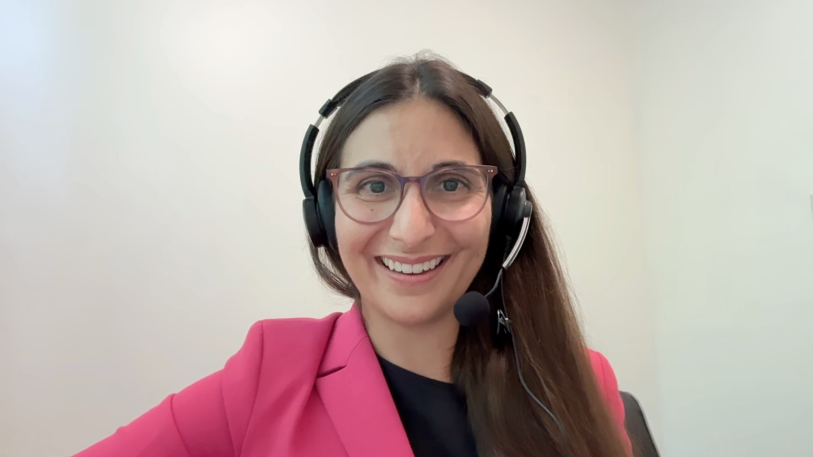
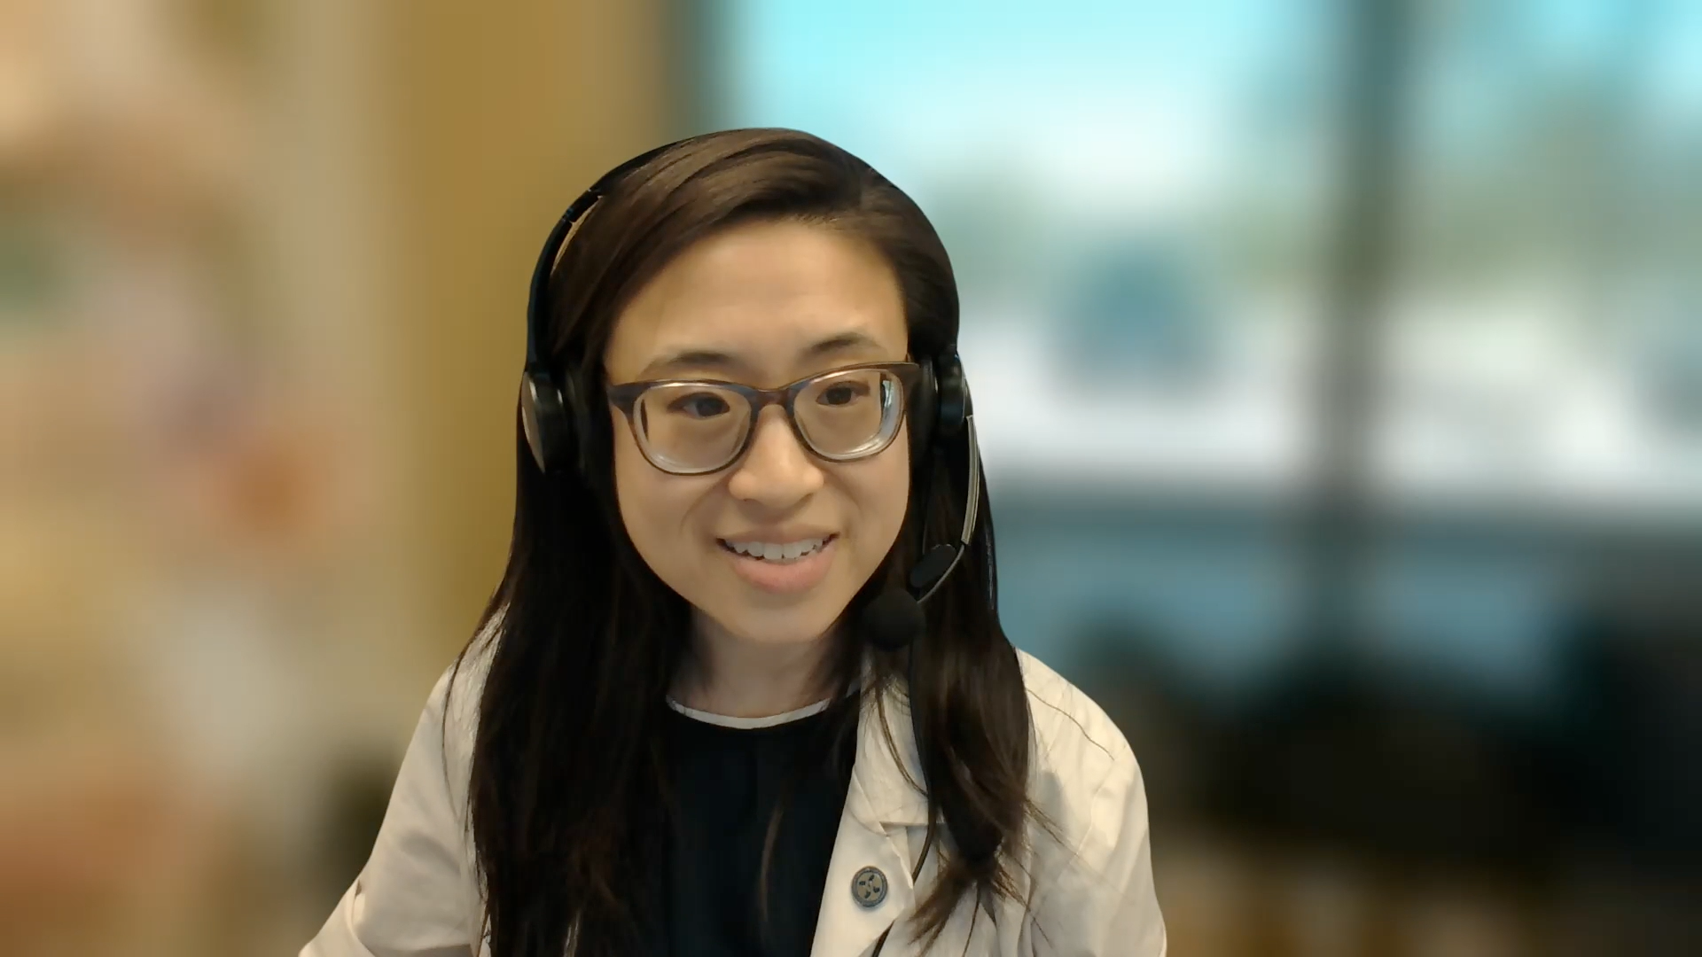
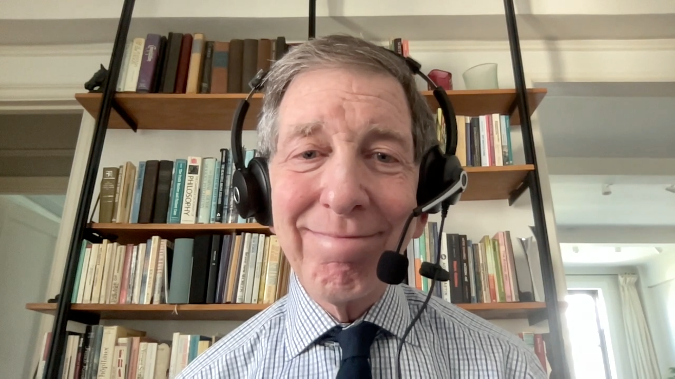
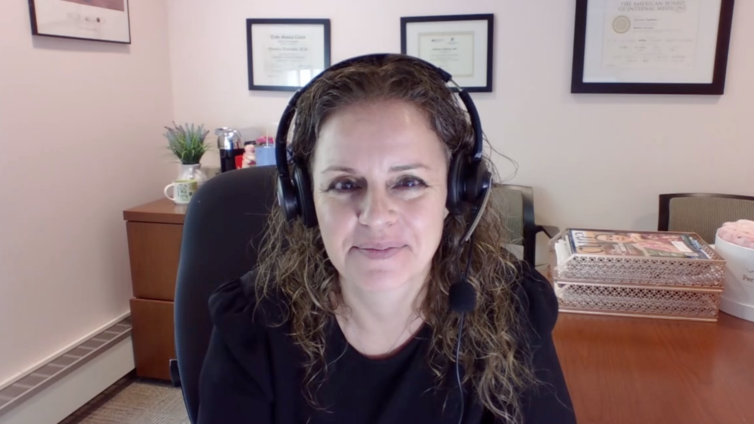
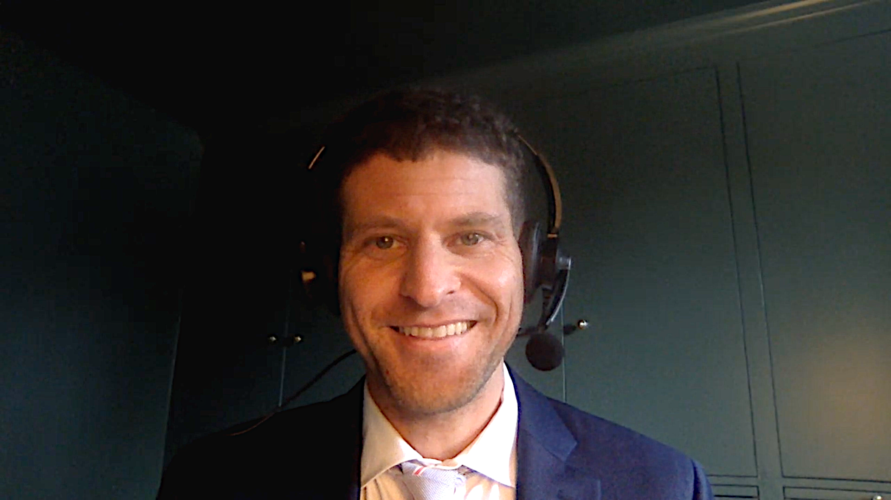
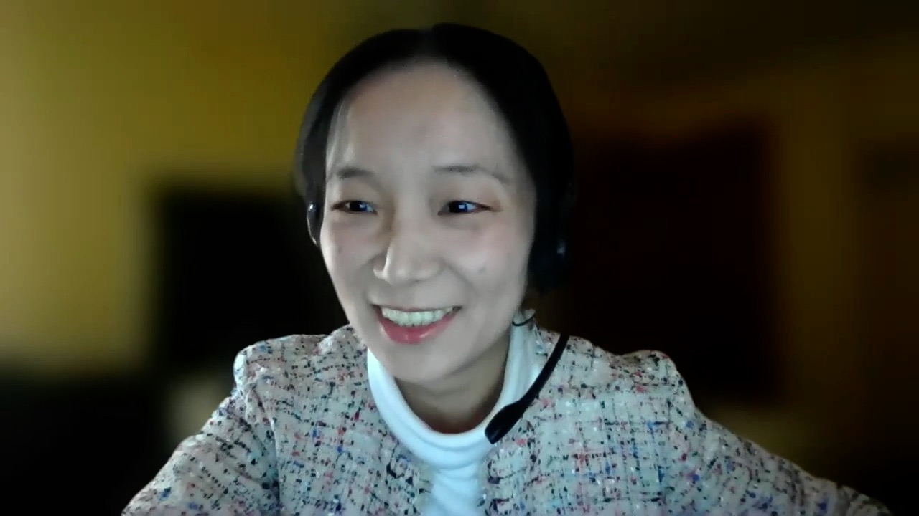
Contributing General Medical Oncologists
Laila Agrawal, MD
Norton Cancer Institute
Louisville, Kentucky
Kimberly Ku, MD
Illinois Cancer Care
Bloomington, Illinois
Alan B Astrow, MD
Weill Cornell Medicine
Brooklyn, New York
Eleonora Teplinsky, MD
Valley-Mount Sinai Comprehensive Cancer Care
Paramus, New Jersey
Eric Fox, DO
Bryn Mawr Medical Specialists Association
Bryn Mawr, Pennsylvania
Lai (Amber) Xu, MD, PhD
Northwest Oncology and Hematology
Rolling Meadows, Illinois

Slide 52
Agenda
Introduction: Antibody-drug conjugates (ADCs) in localized breast cancer
Case 1: Dr Fox – 78-year-old frail woman
Key Datasets: Targeting TROP2 in recurrent metastatic disease
Case 2: Dr Xu – 61-year-old woman
Key Datasets: Management of HER2-low and HER2-ultralow breast cancer
Case 3: Dr Astrow – 74-year-old woman
Key Datasets: TROP2-targeted ADCs as first-line treatment
Case 4: Dr Agrawal – 66-year-old woman
Case 5: Dr Ku – 59-year-old woman
Case 6: Dr Teplinsky – 63-year-old woman

Slide 53
Agenda
Introduction: Antibody-drug conjugates (ADCs) in localized breast cancer
Case 1: Dr Fox – 78-year-old frail woman
Key Datasets: Targeting TROP2 in recurrent metastatic disease
Case 2: Dr Xu – 61-year-old woman
Key Datasets: Management of HER2-low and HER2-ultralow breast cancer
Case 3: Dr Astrow – 74-year-old woman
Key Datasets: TROP2-targeted ADCs as first-line treatment
Case 4: Dr Agrawal – 66-year-old woman
Case 5: Dr Ku – 59-year-old woman
Case 6: Dr Teplinsky – 63-year-old woman

Slide 54
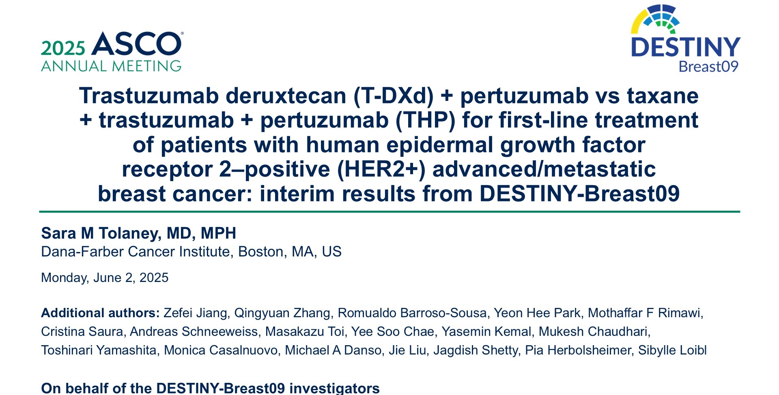
Abstract LBA1008

Slide 55
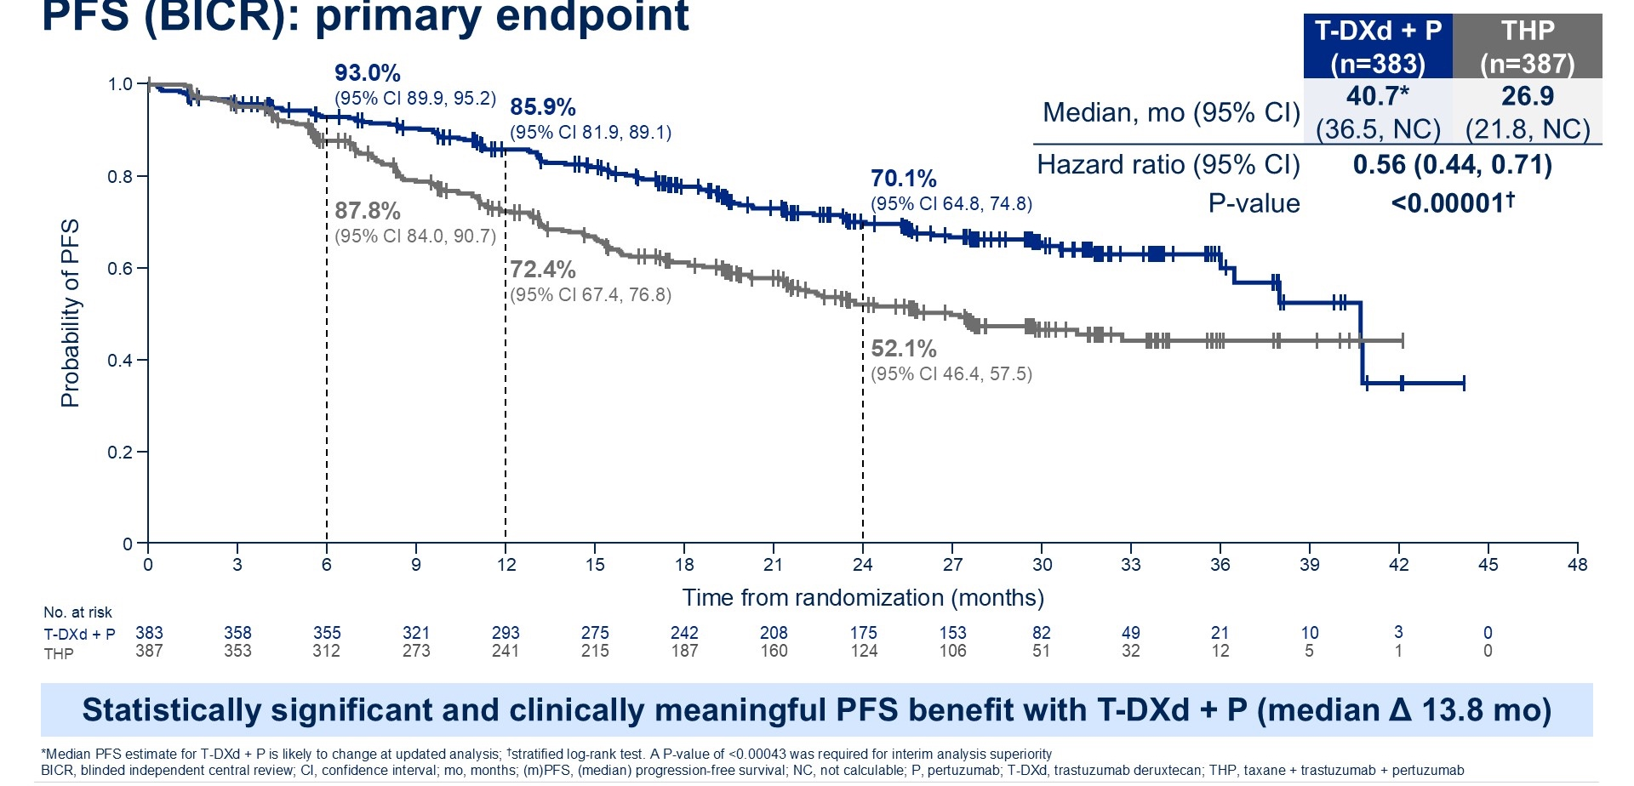
Phase III DESTINY-Breast09 (Interim): PFS (BICR)
Tolaney SM et al. ASCO 2025;Abstract LBA1008.

Slide 56
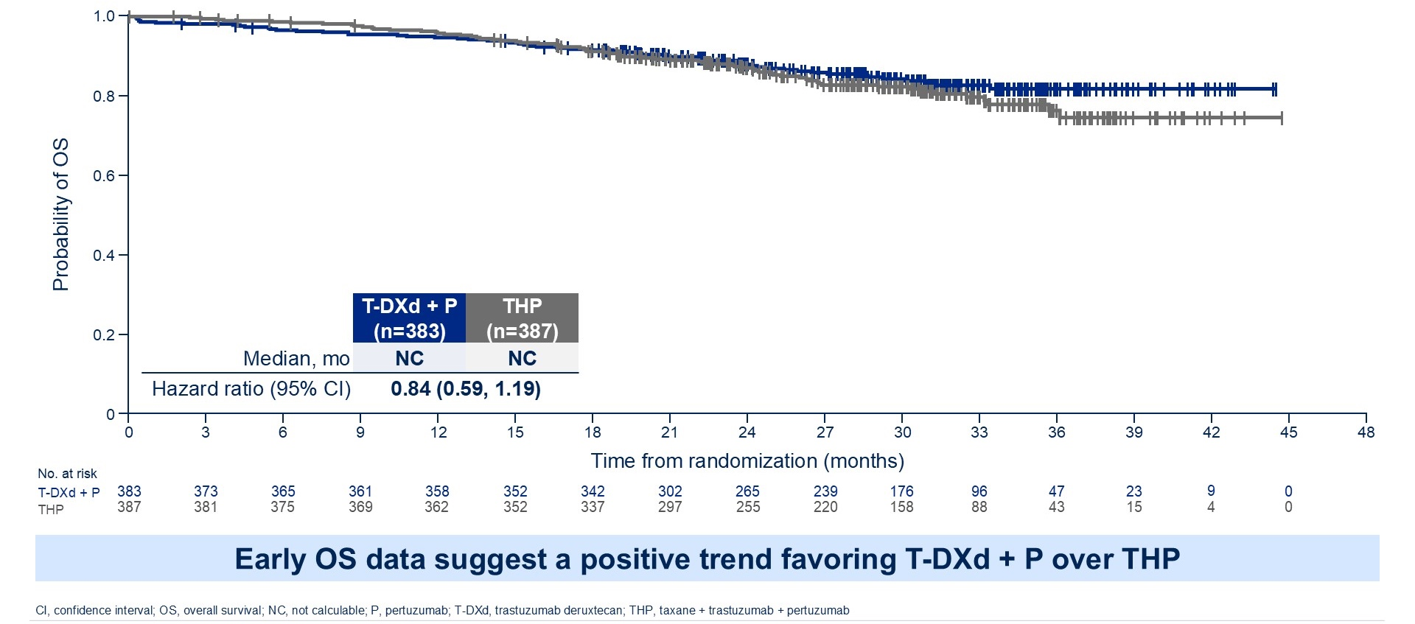
Phase III DESTINY-Breast09 (Interim): OS (~16% Maturity)
Tolaney SM et al. ASCO 2025;Abstract LBA1008.

Slide 57
Trastuzumab Deruxtecan (T-DXd) Followed by THP Before Surgery Showed Statistically Significant and Clinically Meaningful Improvement in Pathologic Complete Response for Patients with High-Risk HER2-Positive Localized Breast Cancer in the DESTINY-Breast11 Phase III Trial Press Release: May 7, 2025
“Positive high-level results from the DESTINY-Breast11 Phase III trial showed T-DXd followed by paclitaxel, trastuzumab and pertuzumab (THP) demonstrated a statistically significant and clinically meaningful improvement in pathologic complete response (pCR) rate versus standard of care (dose-dense doxorubicin and cyclophosphamide followed by THP [ddAC-THP]) when used in the neoadjuvant setting (before surgery) in patients with high-risk, locally advanced HER2-positive early-stage breast cancer. Pathologic complete response is defined as no evidence of invasive cancer cells in the removed breast tissue and lymph nodes following treatment.
The secondary endpoint of event-free survival (EFS) was not mature at the time of analysis; however, EFS data showed an early positive trend favouring T-DXd followed by THP compared to standard of care. The trial will continue to follow EFS.”
https://www.astrazeneca.com/media-centre/press-releases/2025/enhertu-improved-pcr-in-early-stage-breast-cancer.html

Slide 58
T-DXd Demonstrated Highly Statistically Significant and Clinically Meaningful Improvement in Invasive Disease-Free Survival in Comparison to T-DM1 in the DESTINY-Breast05 Phase III Trial for Patients with High-Risk Localized Breast Cancer After Neoadjuvant Therapy Press Release: September 29, 2025
“Positive high-level results from a planned interim analysis of the DESTINY-Breast05 Phase III trial showed trastuzumab deruxtecan demonstrated a highly statistically significant and clinically meaningful improvement in invasive disease-free survival (IDFS) versus trastuzumab emtansine (T-DM1) in patients with HER2-positive early breast cancer with residual invasive disease in the breast or axillary lymph nodes after neoadjuvant treatment and a high risk of disease recurrence. This is the second positive Phase III trial of T-DXd in the HER2-positive early breast cancer setting following positive results from the Destiny-Breast11 Phase III neoadjuvant trial earlier this year.
Overall survival (OS) was not mature at the time of this planned interim analysis and will be assessed at a subsequent analysis.
Data from DESTINY-Breast05 (Abstract #LBA1) and DESTINY-Breast11 (Abstract #291O) will be presented during Presidential Symposium 1 on 18 October at the upcoming European Society for Medical Oncology (ESMO) Congress 2025. The DESTINY-Breast05 data will also be shared with global regulatory authorities.”
https://www.astrazeneca.com/media-centre/press-releases/2025/enhertu-improved-idfs-in-early-bc-in-db-05.html

Slide 59
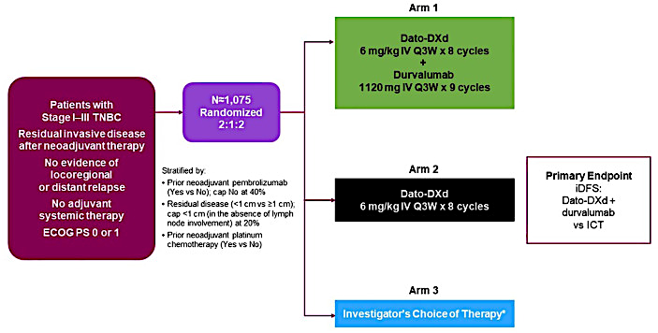
Adjuvant Datopotamab Deruxtecan (Dato-DXd): TROPION-Breast03 Trial
iDFS = invasive disease-free survival; ICT = investigator's choice of therapy
Bardia A et al. Ther Adv Med Oncol 2024 April 29:16:17588359241248336.

Slide 60
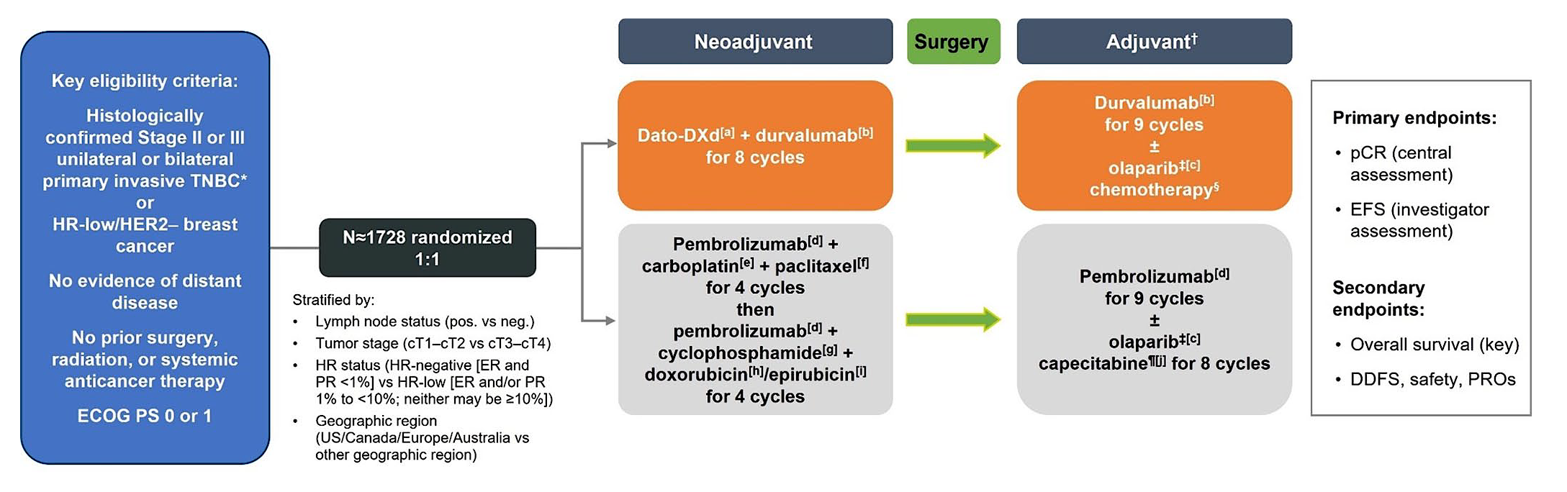
Neodjuvant Dato-DXd: TROPION-Breast04 Trial
pCR = pathological complete response; EFS = event-free survival; DDFS = distant disease-free survival; PROs = patient-reported outcomes
McArthur HL et al. Ther Adv Med Oncol 2025 February 5;17:17588359251316176.

Slide 61
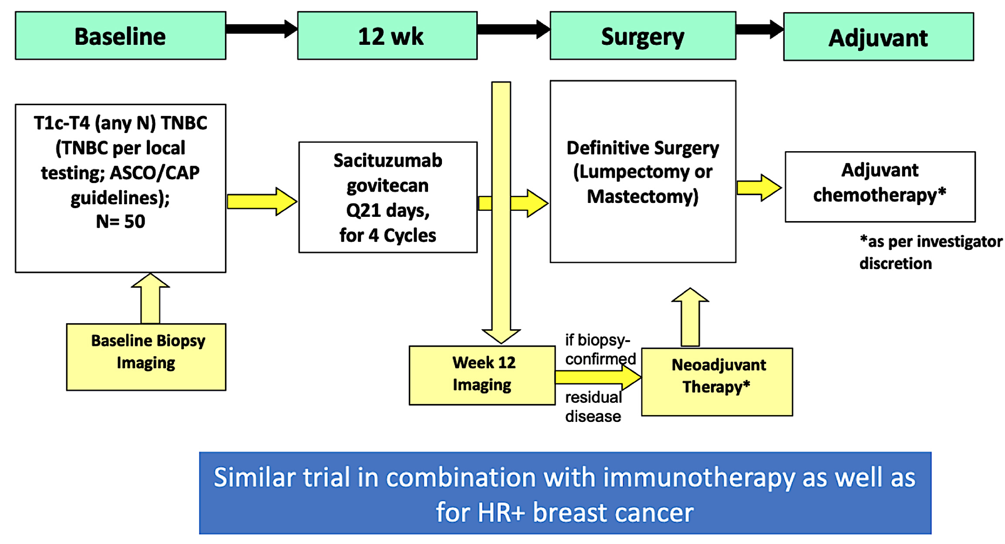
Neoadjuvant Sacituzumab Govitecan: NeoSTAR Trial
Abelman RO et al. Hematol Oncol Clin North Am 2023 February;37(1):151-67.

Slide 62
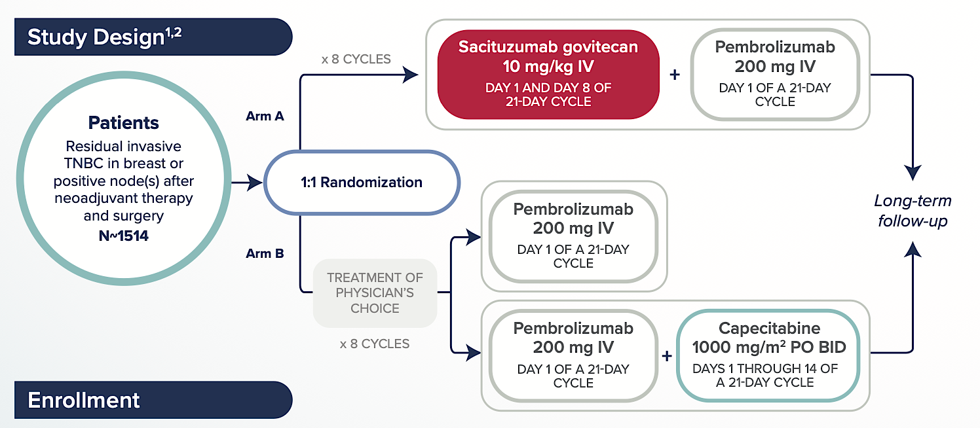
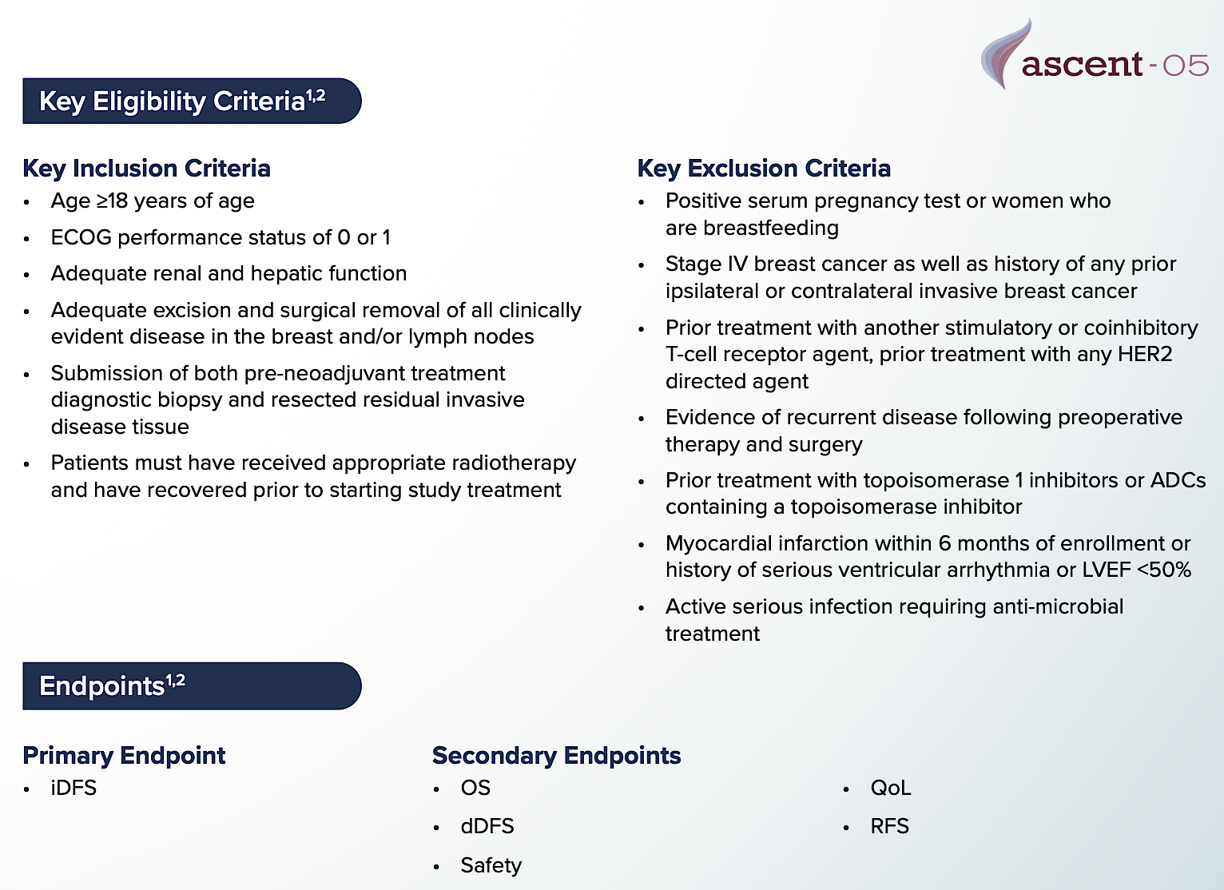
Adjuvant Sacituzumab Govitecan: ASCENT-05/OptimICE-RD Trial
iDFS = invasive disease-free survival; OS = overall survival; dDFS = distant disease-free survival; QoL = quality of life; RFS = recurrence-free survival

Slide 63
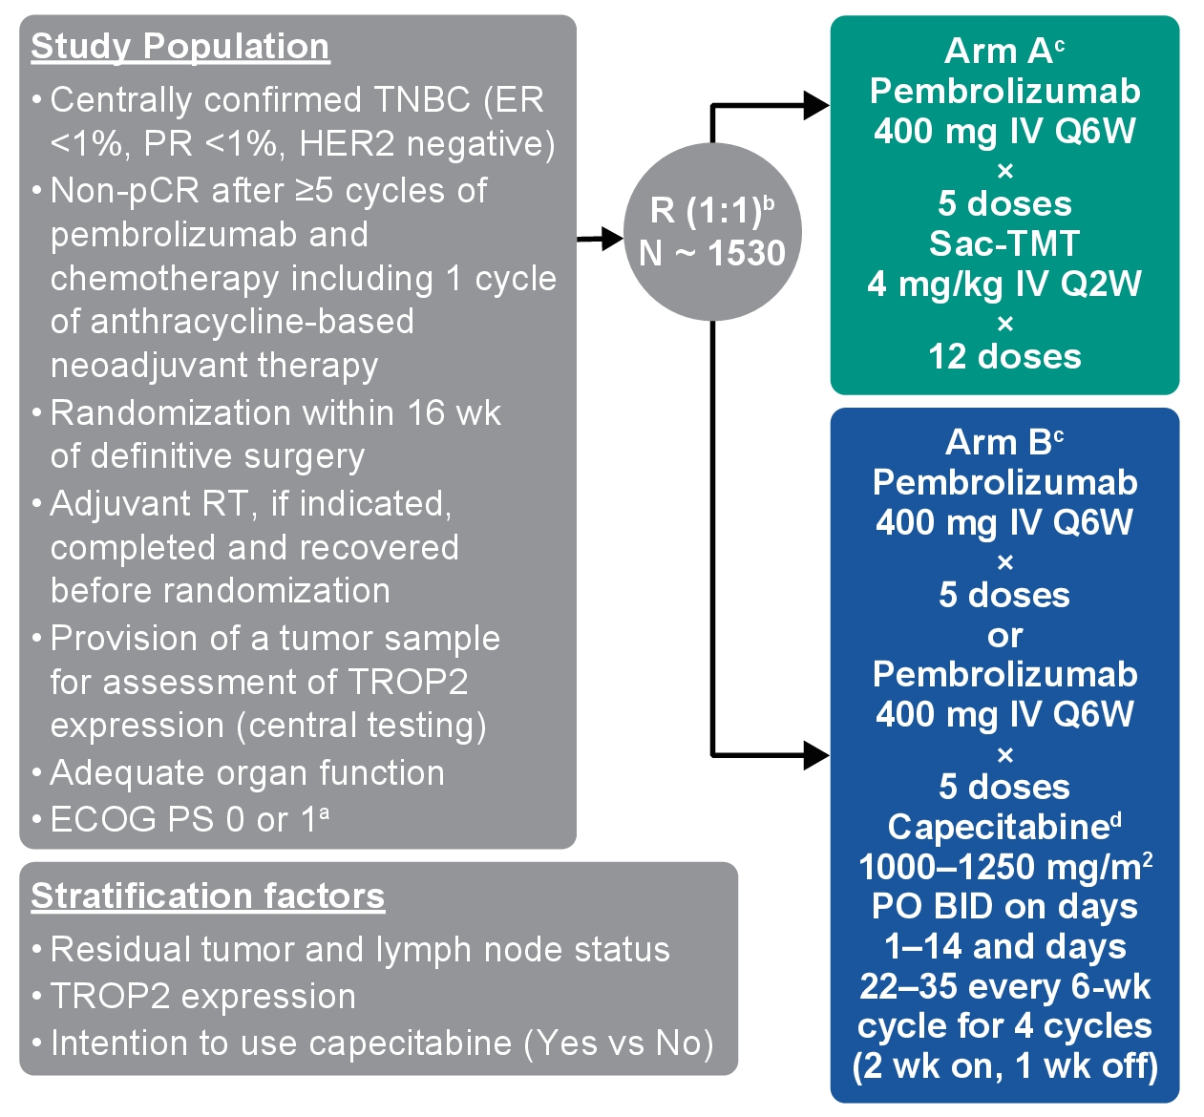
Adjuvant Sacituzumab Tirumotecan (Sac-TMT) + Pembrolizumab: TroFuse-012 Trial
McArther H et al. ASCO 2025;Abstract TPS616.

Slide 64
Agenda
Introduction: Antibody-drug conjugates (ADCs) in localized breast cancer
Case 1: Dr Fox – 78-year-old frail woman
Key Datasets: Targeting TROP2 in recurrent metastatic disease
Case 2: Dr Xu – 61-year-old woman
Key Datasets: Management of HER2-low and HER2-ultralow breast cancer
Case 3: Dr Astrow – 74-year-old woman
Key Datasets: TROP2-targeted ADCs as first-line treatment
Case 4: Dr Agrawal – 66-year-old woman
Case 5: Dr Ku – 59-year-old woman
Case 6: Dr Teplinsky – 63-year-old woman

Slide 65
Case Presentation: 78-year-old frail woman with cough and ER-positive, HER2-low (IHC 1+) mBC s/p multiple lines of therapy receives sacituzumab govitecan
Dr Eric Fox (Bryn Mawr, Pennsylvania)

Slide 66
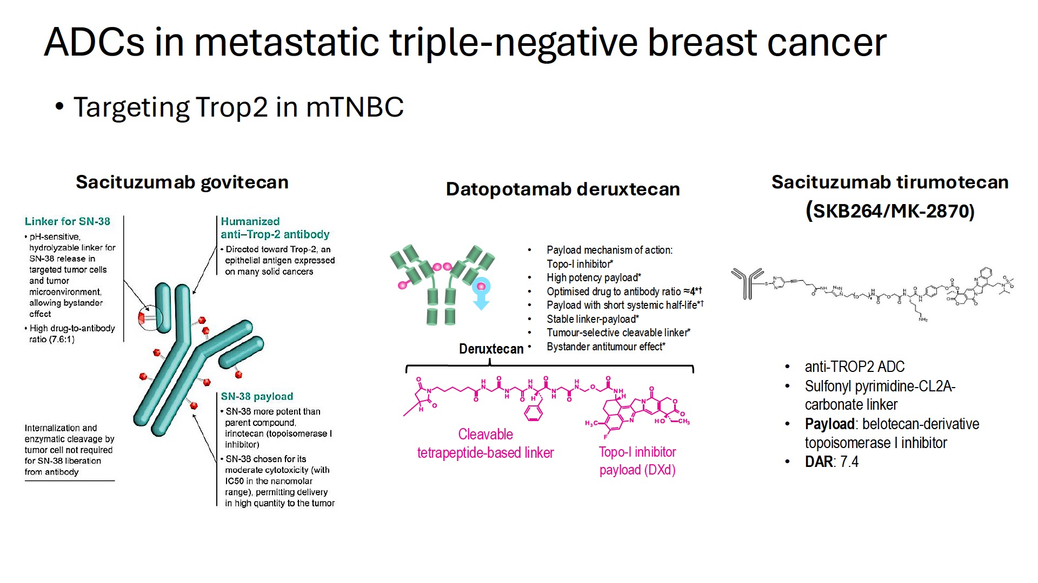
ADCs
Targeting TROP2 in Metastatic Breast Cancer
Courtesy of Rebecca A Dent, MD, MSc

Slide 67
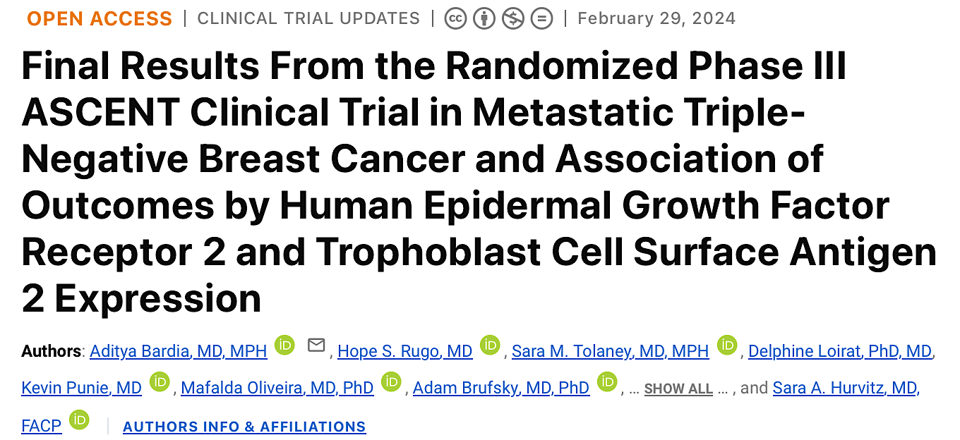
J Clin Oncol;42(15):1738-44.

Slide 68
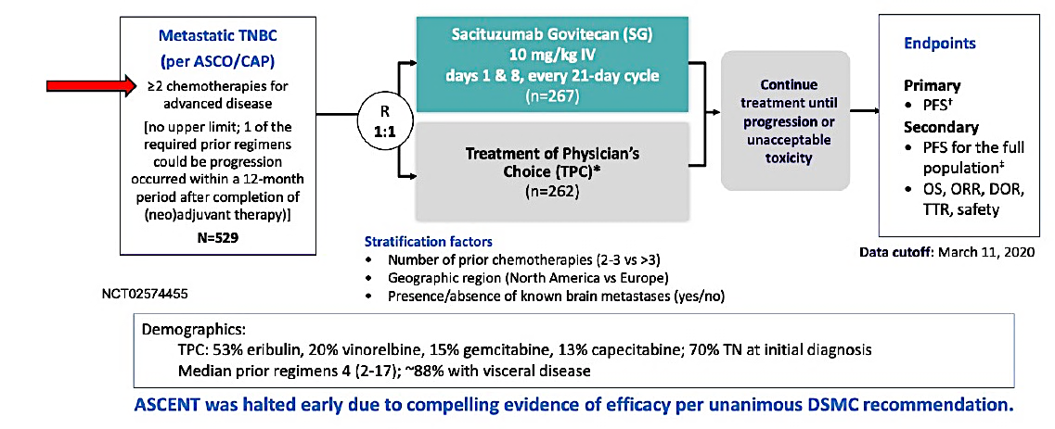
Phase III ASCENT Study Design
TTR = time to response
Bardia A et al. J Clin Oncol 2024;42(15):1738-44.

Slide 69
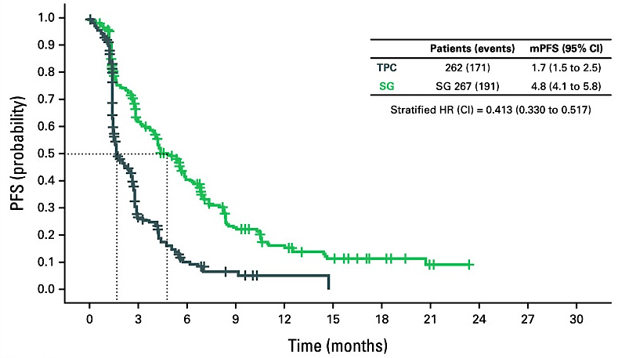
Phase III ASCENT: Progression-Free Survival (PFS)
mPFS = median progression-free survival
Bardia A et al. J Clin Oncol 2024;42(15):1738-44.

Slide 70
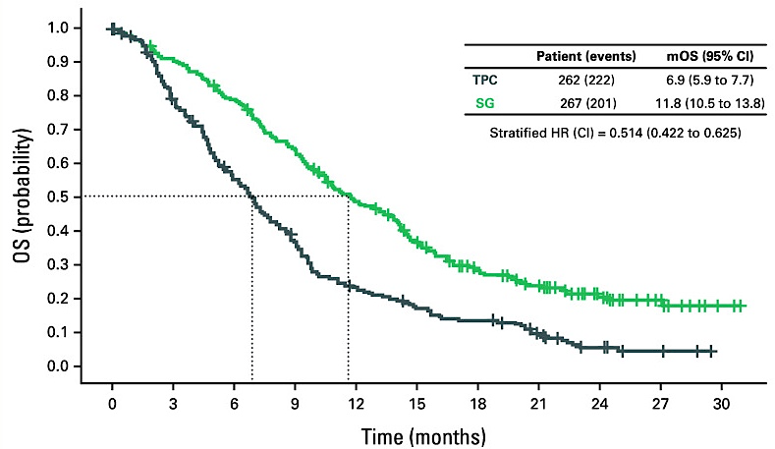
Phase III ASCENT: Overall Survival (OS)
Bardia A et al. J Clin Oncol 2024;42(15):1738-44.

Slide 71
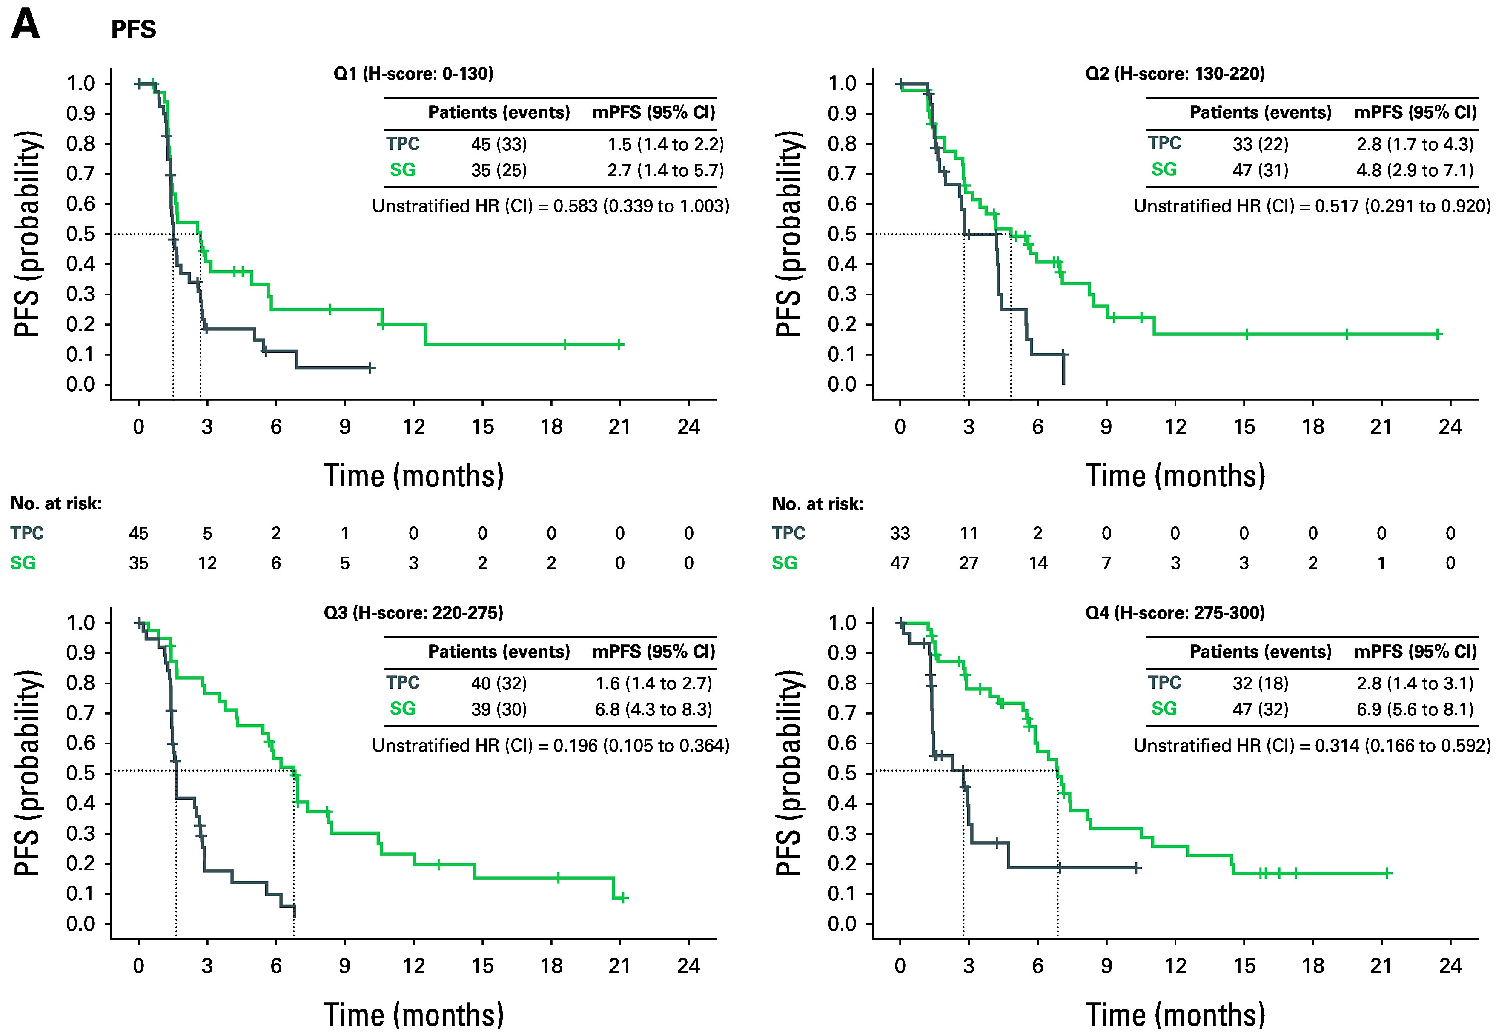
Phase III ASCENT: PFS by TROP2 Expression
Bardia A et al. J Clin Oncol 2024;42(15):1738-44.

Slide 72
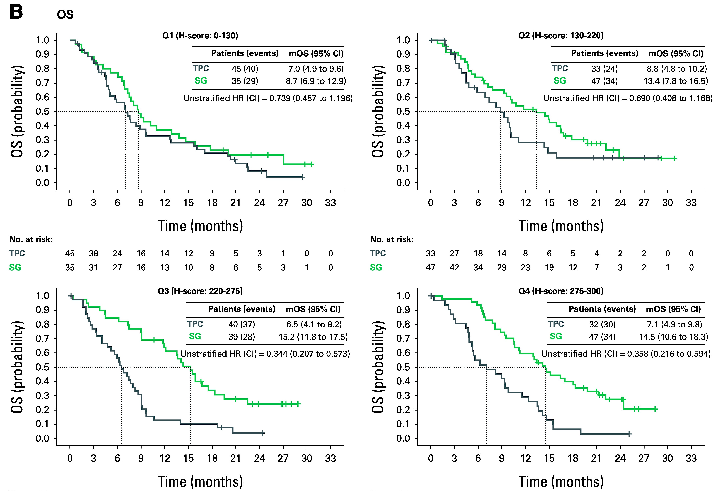
Phase III ASCENT: OS by TROP2 Expression
Bardia A et al. J Clin Oncol 2024;42(15):1738-44.

Slide 73
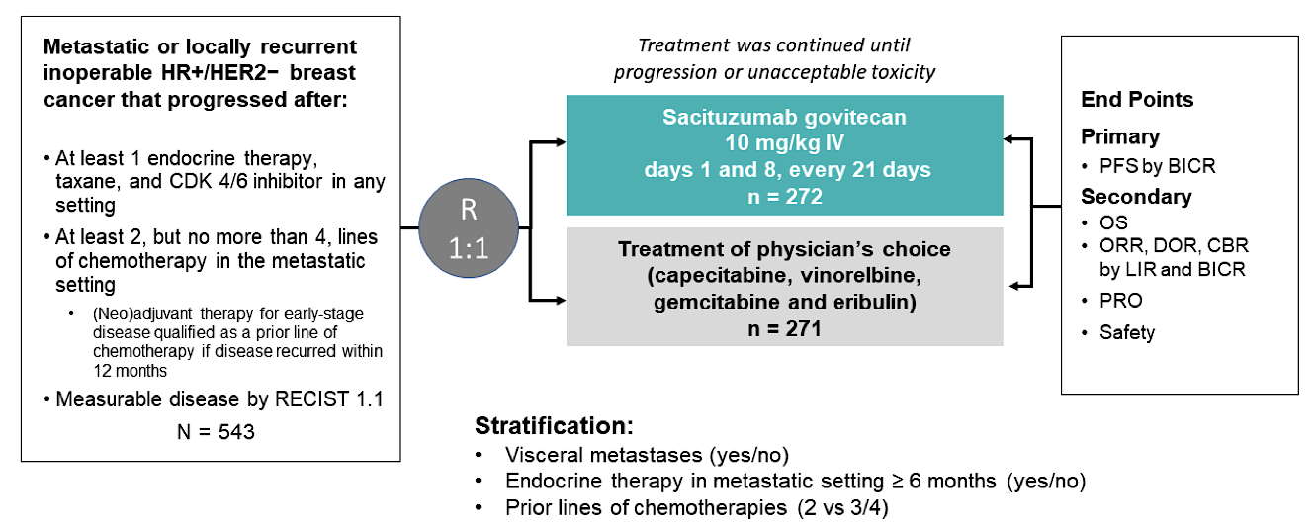
Phase III TROPiCS-02 Study Design
PFS = progression-free survival; BICR = blinded independent central review; OS = overall survival; ORR = objective response rate; DOR = duration of response; CBR = clinical benefit rate; LIR = local investigator review; PRO = patient-reported outcome
Rugo HS et al. Lancet 2023 October 21;402(10411):1423-33.

Slide 74
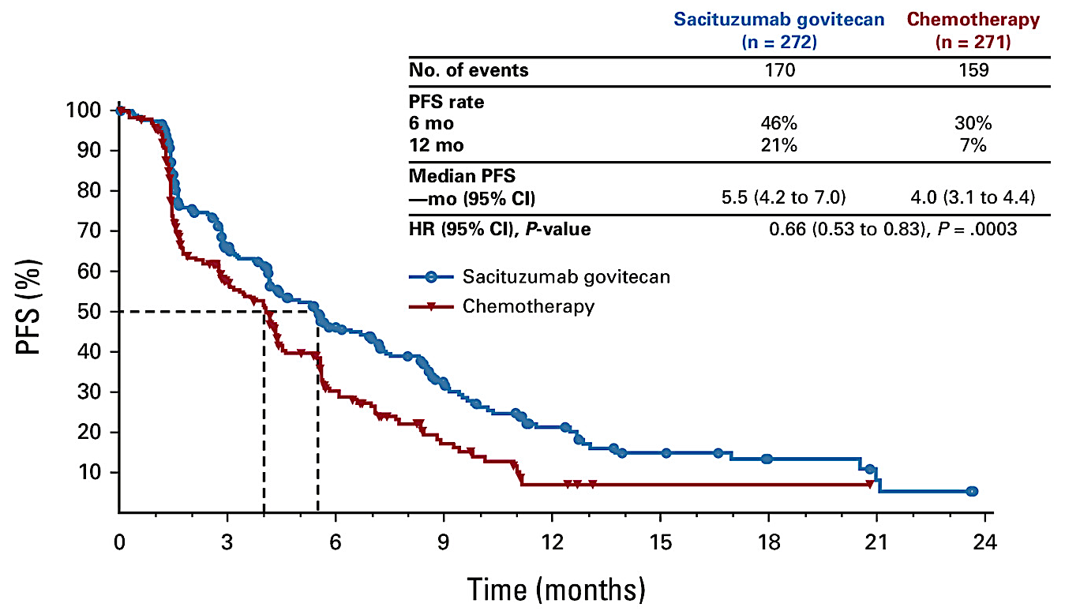
Phase III TROPiCS-02: Final PFS (Intent-to-Treat Population)
Rugo HS et al. J Clin Oncol 2022 October 10;40(29):3365-76.

Slide 75
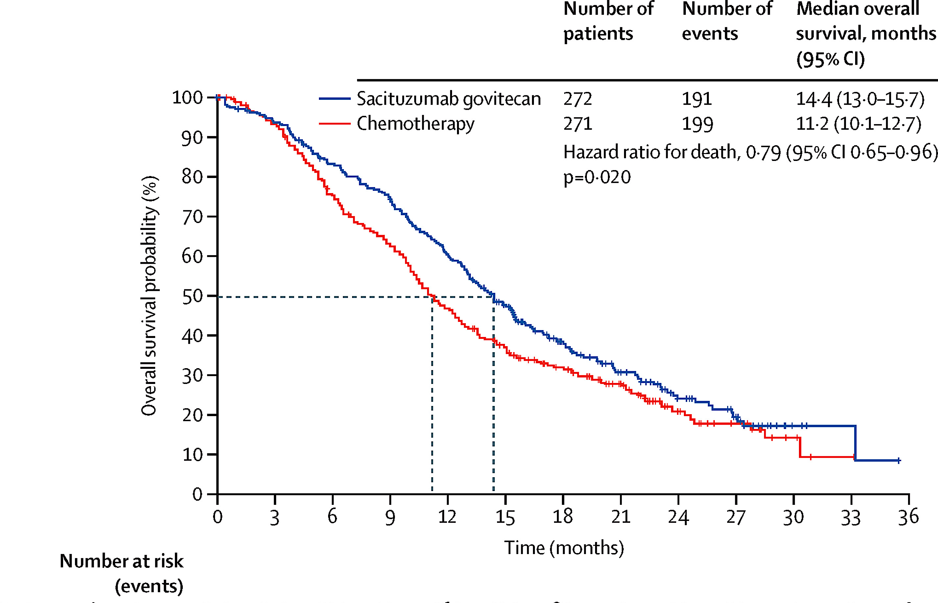
Phase III TROPiCS-02: Final OS (Intent-to-Treat Population)
Rugo HS et al. Lancet 2023 October 21;402(10411):1423-33.

Slide 76
FDA Approves Datopotamab Deruxtecan-dlnk for Unresectable or Metastatic HR-Positive, HER2-Negative Breast Cancer Press Release: January 17, 2025
“On January 17, 2025, the Food and Drug Administration approved datopotamab deruxtecan-dlnk, a Trop-2-directed antibody and topoisomerase inhibitor conjugate, for adult patients with unresectable or metastatic, hormone receptor (HR)-positive, human epidermal growth factor receptor 2 (HER2)-negative (IHC 0, IHC1+ or IHC2+/ISH-) breast cancer who have received prior endocrine-based therapy and chemotherapy for unresectable or metastatic disease.
Efficacy was evaluated in TROPION-Breast01 (NCT05104866), a multicenter, open-label, randomized trial. Patients must have experienced disease progression, been deemed unsuitable for further endocrine therapy, and have received one or two lines of prior chemotherapy for unresectable or metastatic disease. Patients were excluded for a history of ILD/pneumonitis requiring steroids, ongoing ILD/pneumonitis, clinically active brain metastases, or clinically significant corneal disease. Patients also were excluded for ECOG performance status >1.”
https://www.fda.gov/drugs/resources-information-approved-drugs/fda-approves-datopotamab-deruxtecan-dlnk-unresectable-or-metastatic-hr-positive-her2-negative-breast

Slide 77
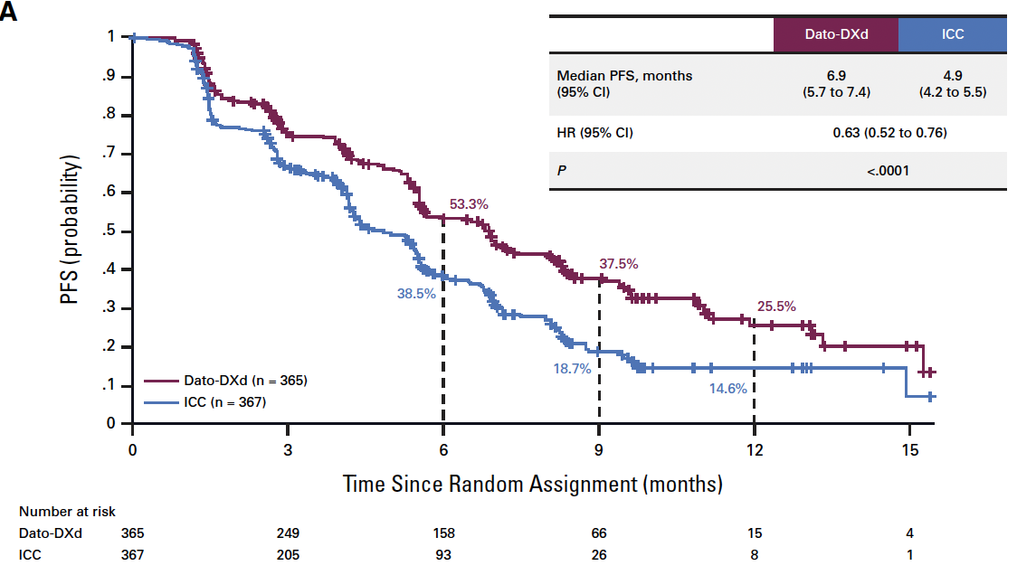
Phase III TROPION-Breast01: Progression-Free Survival (PFS)
PFS
Bardia A et al. J Clin Oncol 2025;43(3):285-96.
Dato-DXd = datopotamab deruxtecan; ICC = investigator's choice of chemotherapy

Slide 78
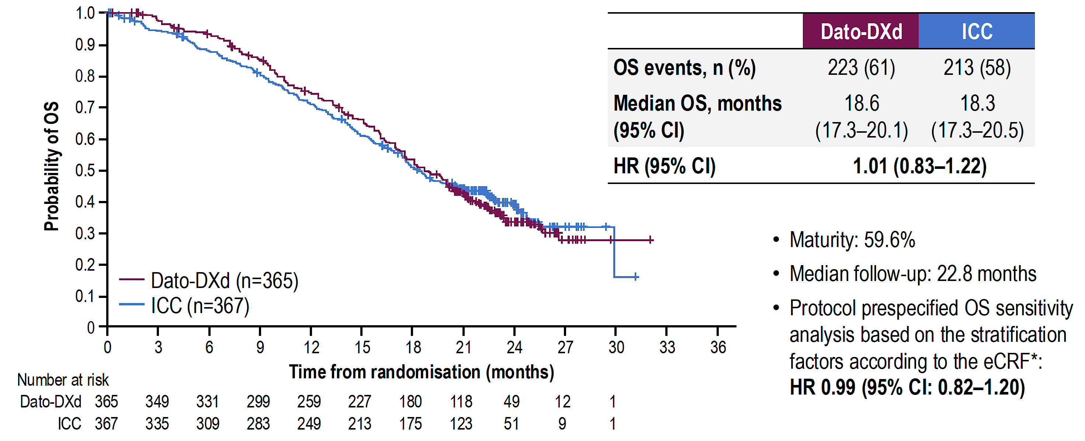
Phase III TROPION-Breast01: Overall Survival
Pistilli B et al. ESMO Virtual Plenary 2025;Abstract VP1-2025.

Slide 79
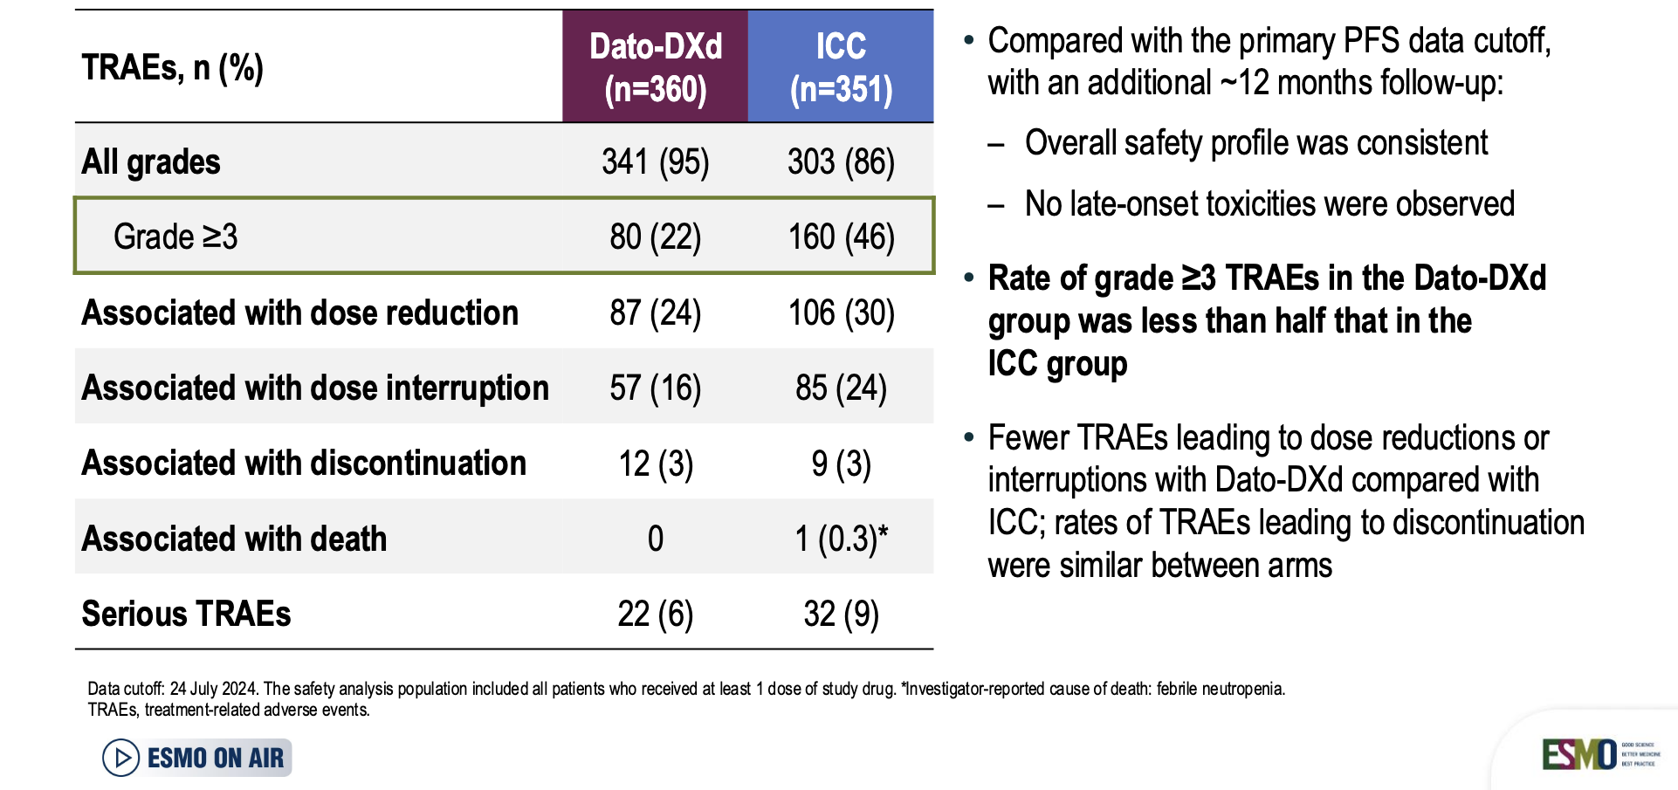
Phase III TROPION-Breast01: Overall Safety Summary
Pistilli B et al. ESMO Virtual Plenary 2025;Abstract VP1-2025.

Slide 80
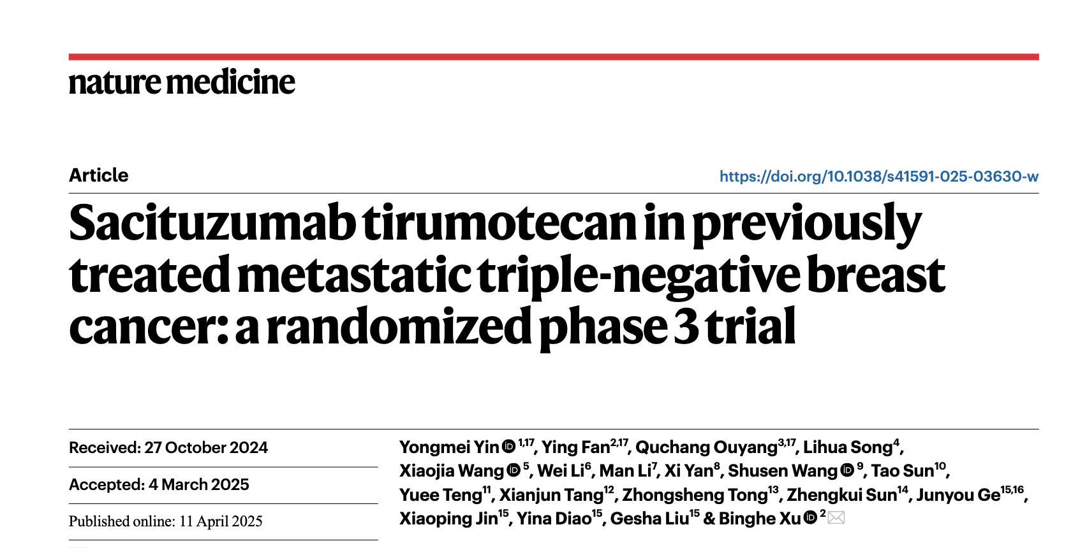

Slide 81
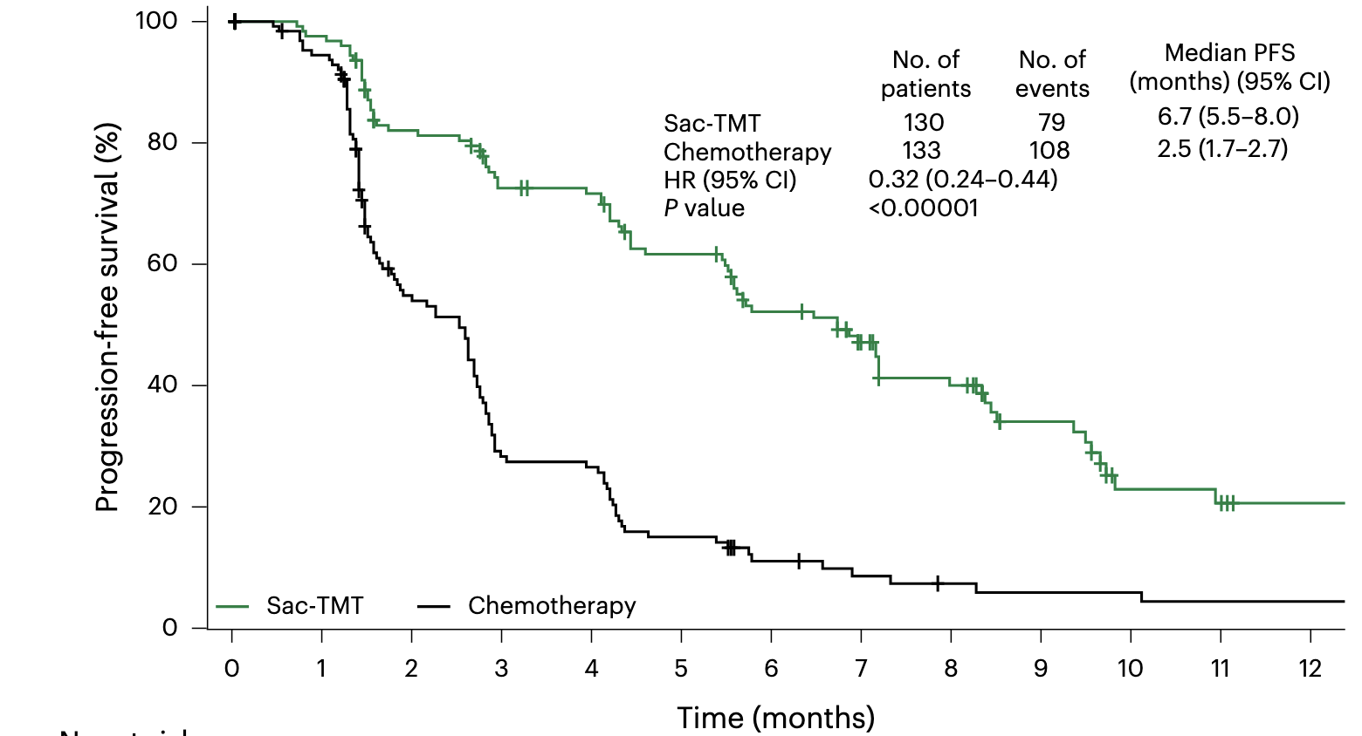
Phase III OptiTROP-Breast01 Trial: Final PFS Analysis by BICR
Yin Y et al. Nat Med 2025;31(6):1969-75.

Slide 82
ESMO 2025 Abstracts of Interest (HR-Positive, HER2-Negative mBC)
Sacituzumab Tirumotecan
LBA23 — Sacituzumab tirumotecan (sac-TMT) vs investigator's choice of chemotherapy (ICC) in previously treated locally advanced or metastatic hormone receptor-positive, HER2-negative (HR+/HER2-) breast cancer (BC): Results from the randomized, multi-center phase 3 OptiTROP-Breast02 study Speaker: Ying Fan

Slide 83
Agenda
Introduction: Antibody-drug conjugates (ADCs) in localized breast cancer
Case 1: Dr Fox – 78-year-old frail woman
Key Datasets: Targeting TROP2 in recurrent metastatic disease
Case 2: Dr Xu – 61-year-old woman
Key Datasets: Management of HER2-low and HER2-ultralow breast cancer
Case 3: Dr Astrow – 74-year-old woman
Key Datasets: TROP2-targeted ADCs as first-line treatment
Case 4: Dr Agrawal – 66-year-old woman
Case 5: Dr Ku – 59-year-old woman
Case 6: Dr Teplinsky – 63-year-old woman

Slide 84
Case Presentation: 61-year-old woman with NTRK-mutant ER-negative, HER2-low (IHC 2+) recurrent mBC and PD on chemoimmunotherapy and larotrectinib receives trastuzumab deruxtecan
Dr Amber Xu (Rolling Meadows, Illinois)

Slide 85
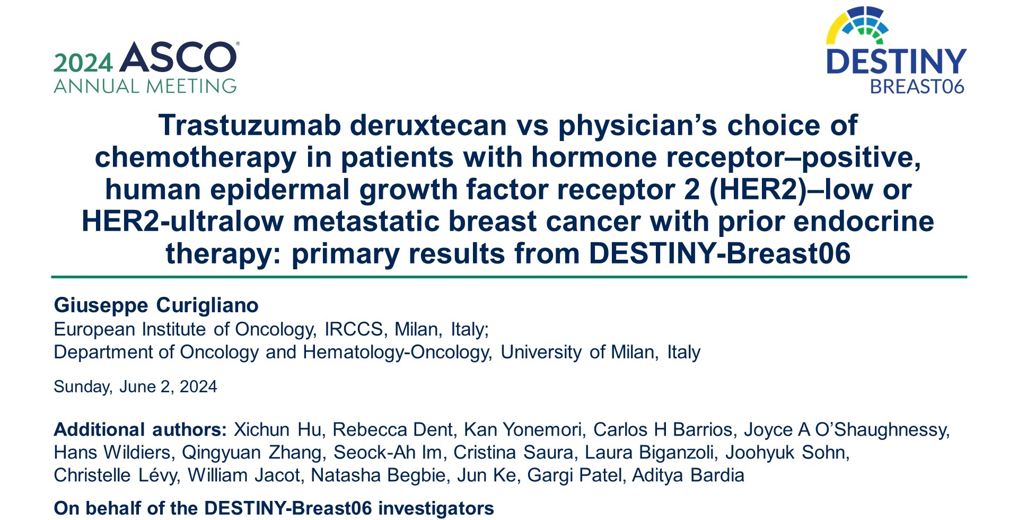
Abstract LBA1000

Slide 86
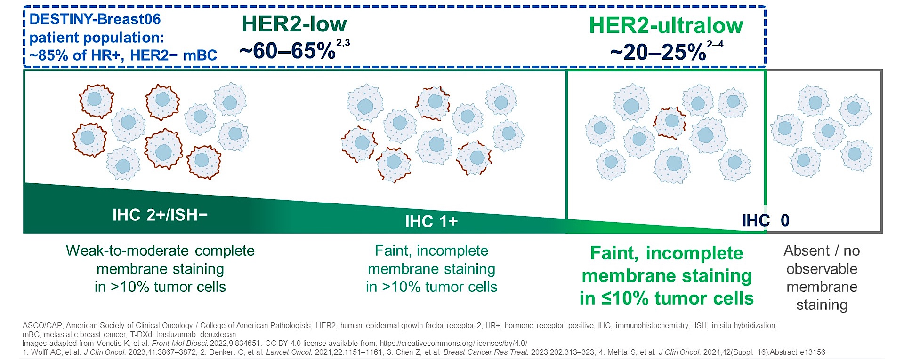
HER2-Low and Ultralow Disease
Curigliano G et al. ASCO 2024;Abstract LBA1000.

Slide 87
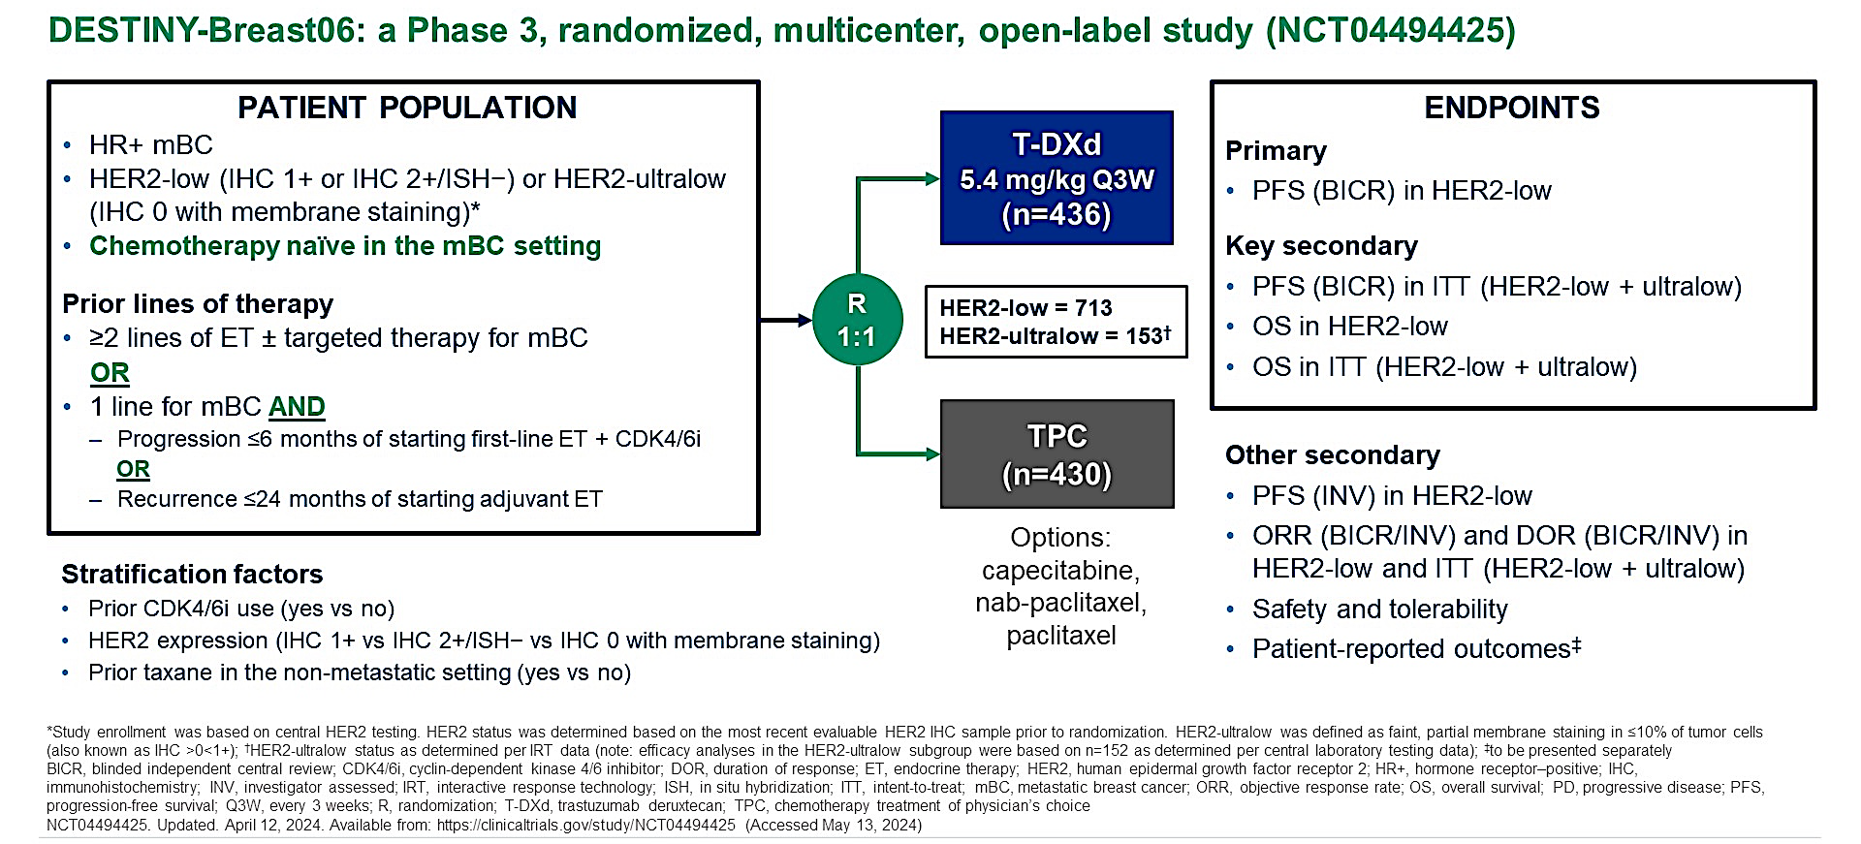
Phase III DESTINY-Breast06 Study Design
Curigliano G et al. ASCO 2024;Abstract LBA1000.

Slide 88
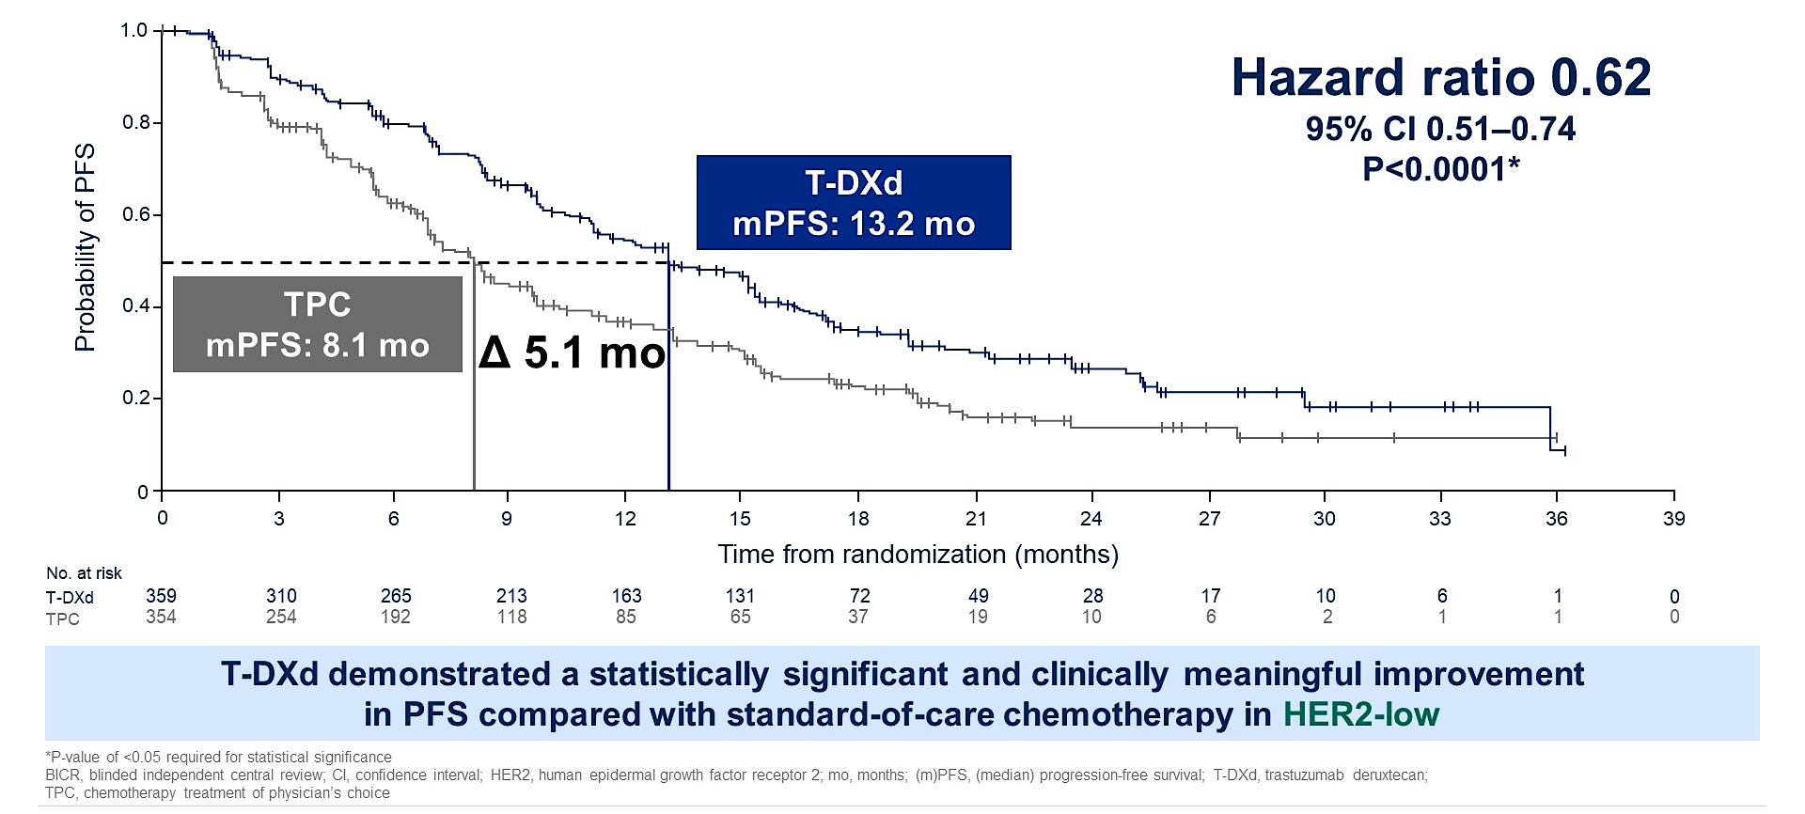
Phase III DESTINY-Breast06: PFS in HER2-Low Disease (Primary Endpoint)
Curigliano G et al. ASCO 2024;Abstract LBA1000.

Slide 89
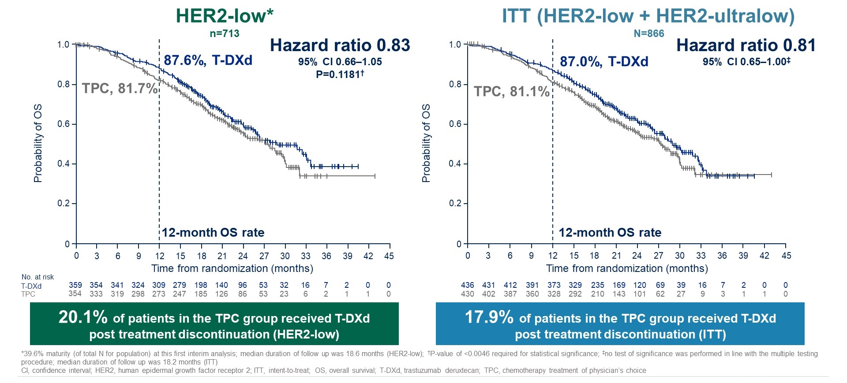
Phase III DESTINY-Breast06: Overall Survival (~40% Maturity)
Curigliano G et al. ASCO 2024;Abstract LBA1000.

Slide 90
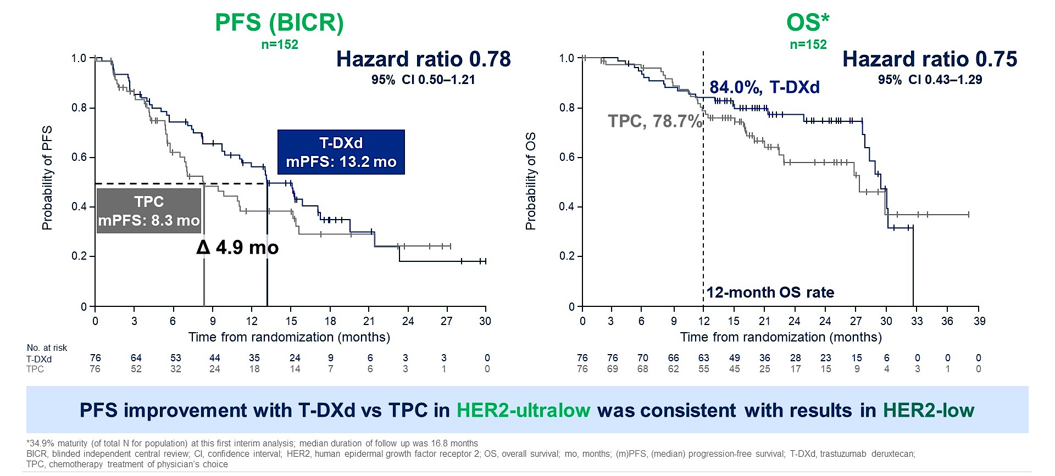
Phase III DESTINY-Breast06: Survival in HER2-Ultralow Disease
Curigliano G et al. ASCO 2024;Abstract LBA1000.

Slide 91

Phase III DESTINY-Breast06: Activity by HER2 Expression
Curigliano G et al. ASCO 2024;Abstract LBA1000.

Slide 92
Agenda
Introduction: Antibody-drug conjugates (ADCs) in localized breast cancer
Case 1: Dr Fox – 78-year-old frail woman
Key Datasets: Targeting TROP2 in recurrent metastatic disease
Case 2: Dr Xu – 61-year-old woman
Key Datasets: Management of HER2-low and HER2-ultralow breast cancer
Case 3: Dr Astrow – 74-year-old woman
Key Datasets: TROP2-targeted ADCs as first-line treatment
Case 4: Dr Agrawal – 66-year-old woman
Case 5: Dr Ku – 59-year-old woman
Case 6: Dr Teplinsky – 63-year-old woman

Slide 93
Case Presentation: 74-year-old woman with PIK3CA-mutant recurrent mTNBC and PMH of diverticular abscess on prior neoadjuvant chemoimmunotherapy (KN-522) receives sacituzumab govitecan and pembrolizumab
Dr Alan Astrow (Brooklyn, New York)

Slide 94

ASCO 2025;Abstract LBA109.

Slide 95

Phase III ASCENT-04/KEYNOTE-D19 Study Design
SG = sacituzumb govitecan; pembro = pembrolizumab; ORR = objective response rate; QoL = quality of life
Tolaney SM et al. ASCO 2025;Abstract LBA109.

Slide 96

Phase III ASCENT-04/KEYNOTE-D19: Progression-Free Survival by BICR
BICR = blinded independent central review
Tolaney SM et al. ASCO 2025;Abstract LBA109.

Slide 97

Phase III ASCENT-04/KEYNOTE-D19: Descriptive Overall Survival at Primary Analysis
Tolaney SM et al. ASCO 2025;Abstract LBA109.

Slide 98

ADCS + IO for mTNBC
Courtesy of Rebecca A Dent, MD, MSc

Slide 99
ASCENT-03: First-Line Sacituzumab Govitecan Demonstrates Highly Statistically Significant and Clinically Meaningful Improvement in PFS for Patients with mTNBC Who Are Not Candidates for Checkpoint Inhibitors Press Release: May 23, 2025
“[The manufacturer] announced positive topline results from the Phase 3 ASCENT-03 study of sacituzumab govitecan-hziy. The study met its primary endpoint, demonstrating a highly statistically significant and clinically meaningful improvement in progression-free survival (PFS) compared to chemotherapy in patients with first-line metastatic triple-negative breast cancer (mTNBC) who are not candidates for PD-1/PD-L1 inhibitors, meaning they are PD-L1 negative or are ineligible to receive immunotherapy.
The safety profile of sacituzumab govitecan-hziy in the ASCENT-03 study was consistent with prior studies, and no new safety signals were identified in this patient population. Overall survival (OS) is a key secondary endpoint and was not mature at the time of PFS primary analysis. No OS detriment was observed.”
ESMO 2025 (LBA20) — Primary results from ASCENT-03: A randomized phase 3 study of sacituzumab govitecan (SG) vs chemotherapy (chemo) in patients (pts) with previously untreated advanced triple-negative breast cancer (TNBC) who are unable to receive PD-(L)1 inhibitors (PD-[L]1i) Speaker: Javier C Cortés
https://www.gilead.com/news/news-details/2025/ascent-03-trodelvy-demonstrates-highly-statistically-significant--clinically-meaningful-improvement-in-progression-free-survival-in-patients-with-first-line-metastatic-triple-negative-breast

Slide 100

TROPION_breast02 and 05
Courtesy of Sara M Tolaney, MD, MPH

Slide 101

TroFuse-010 Study Design
Tolaney et al. SABCS 2024;Abstract P4-08-09.

Slide 102
ESMO 2025 Abstracts of Interest (TNBC)
Sacituzumab govitecan
LBA20 — Primary results from ASCENT-03: A randomized phase 3 study of sacituzumab govitecan (SG) vs chemotherapy (chemo) in patients (pts) with previously untreated advanced triple-negative breast cancer (TNBC) who are unable to receive PD-(L)1 inhibitors (PD-[L]1i) Speaker: Javier C Cortés
LBA22 — Patient-reported outcomes (PROs) with sacituzumab govitecan (SG) + pembrolizumab (pembro) vs chemotherapy (chemo) + pembro in patients (pts) with previously untreated PD-L1+ metastatic triple-negative breast cancer (mTNBC) in the phase 3 ASCENT-04/KEYNOTE-D19 study Speaker: Evandro De Azambuja
Datopotamab deruxtecan
555MO — Datopotamab deruxtecan (Dato-DXd) + durvalumab (D) as first-line (1L) treatment (tx) for unresectable locally advanced/metastatic triple-negative breast cancer (a/mTNBC): Final results from the phase 1b/2 BEGONIA study Speaker: Peter Schmid

Slide 103
Agenda
Introduction: Antibody-drug conjugates (ADCs) in localized breast cancer
Case 1: Dr Fox – 78-year-old frail woman
Key Datasets: Targeting TROP2 in recurrent metastatic disease
Case 2: Dr Xu – 61-year-old woman
Key Datasets: Management of HER2-low and HER2-ultralow breast cancer
Case 3: Dr Astrow – 74-year-old woman
Key Datasets: TROP2-targeted ADCs as first-line treatment
Case 4: Dr Agrawal – 66-year-old woman
Case 5: Dr Ku – 59-year-old woman
Case 6: Dr Teplinsky – 63-year-old woman

Slide 104
Case Presentation: 66-year-old woman with ER-negative, HER2-low (IHC 1+) mBC receives sacituzumab govitecan after PD on capecitabine
Dr Laila Agrawal (Louisville, Kentucky)

Slide 105
Agenda
Introduction: Antibody-drug conjugates (ADCs) in localized breast cancer
Case 1: Dr Fox – 78-year-old frail woman
Key Datasets: Targeting TROP2 in recurrent metastatic disease
Case 2: Dr Xu – 61-year-old woman
Key Datasets: Management of HER2-low and HER2-ultralow breast cancer
Case 3: Dr Astrow – 74-year-old woman
Key Datasets: TROP2-targeted ADCs as first-line treatment
Case 4: Dr Agrawal – 66-year-old woman
Case 5: Dr Ku – 59-year-old woman
Case 6: Dr Teplinsky – 63-year-old woman

Slide 106
Case Presentation: 59-year-old woman with recurrent ER-negative, HER2-low mBC and PD on sacituzumab govitecan receives trastuzumab deruxtecan
Dr Kimberly Ku (Bloomington, Illinois)

Slide 107
Agenda
Introduction: Antibody-drug conjugates (ADCs) in localized breast cancer
Case 1: Dr Fox – 78-year-old frail woman
Key Datasets: Targeting TROP2 in recurrent metastatic disease
Case 2: Dr Xu – 61-year-old woman
Key Datasets: Management of HER2-low and HER2-ultralow breast cancer
Case 3: Dr Astrow – 74-year-old woman
Key Datasets: TROP2-targeted ADCs as first-line treatment
Case 4: Dr Agrawal – 66-year-old woman
Case 5: Dr Ku – 59-year-old woman
Case 6: Dr Teplinsky – 63-year-old woman

Slide 108
Case Presentation: 63-year-old woman with ER-positive, HER2-low mBC with hyperglycemia and disease progression on capivasertib/fulvestrant receives trastuzumab deruxtecan
Dr Eleonora Teplinsky (Paramus, New Jersey)

Slide 109
Contributing General Medical Oncologists
Laila Agrawal, MD
Norton Cancer Institute
Louisville, Kentucky
Kimberly Ku, MD
Illinois Cancer Care
Bloomington, Illinois
Alan B Astrow, MD
Weill Cornell Medicine
Brooklyn, New York
Eleonora Teplinsky, MD
Valley-Mount Sinai Comprehensive Cancer Care
Paramus, New Jersey
Eric Fox, DO
Bryn Mawr Medical Specialists Association
Bryn Mawr, Pennsylvania
Lai (Amber) Xu, MD, PhD
Northwest Oncology and Hematology
Rolling Meadows, Illinois

Slide 110
Data + Perspectives: Clinical Investigators Explore the Application of Recent Datasets in Current Oncology Care
A Multitumor Symposium in Partnership with Florida Cancer Specialists & Research Institute
Saturday, October 11, 2025 7:15 AM – 12:30 PM ET
The Ritz-Carlton Orlando, Grande Lakes | Orlando, Florida
Faculty
Emmanuel S Antonarakis, MD Harold J Burstein, MD, PhD
Matthew P Goetz, MD
Christopher Lieu, MD Matthew Lunning, DO
Heather McArthur, MD, MPH, FASCO Rita Nanda, MD
Matthew R Smith, MD, PhD
Sonali M Smith, MD
John Strickler, MD
Moderator
Neil Love, MD

Slide 111
Thank you for joining us! Please take a moment to complete the survey currently up on Zoom. Your feedback is very important to us. The survey will remain open for 5 minutes after the meeting ends. Information on how to obtain CME, ABIM MOC and ABS credit is provided in the Zoom chat room. Attendees will also receive an email in 1 to 3 business days with these instructions.

