Slide 1
Practical Perspectives: Experts Review Actual Cases of Patients with Small Cell Lung Cancer
A CME/MOC-Accredited Live Webinar
Wednesday, July 16, 2025 5:00 PM – 6:00 PM ET
Faculty
Stephen V Liu, MD
Charles Rudin, MD, PhD
Moderator
Neil Love, MD

Slide 2
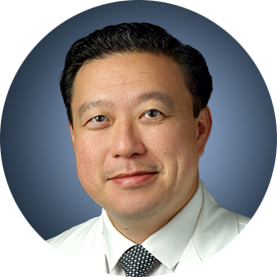
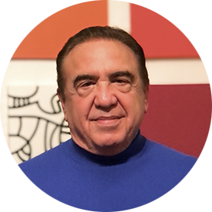
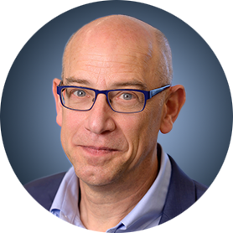
Faculty
Stephen V Liu, MD
Associate Professor of Medicine
Georgetown University Hospital
Washington, DC
MODERATOR
Neil Love, MD Research To Practice Miami, Florida
Charles Rudin, MD, PhD
Deputy Director, MSK
Sylvia Hassenfeld Chair in Lung Cancer Research
Co-Director, Druckenmiller Center for
Lung Cancer Research
Memorial Sloan Kettering Cancer Center
Professor of Medicine
Weill Cornell Medical College
New York, New York

Slide 3
Commercial Support
This activity is supported by educational grants from AstraZeneca Pharmaceuticals LP, Daiichi Sankyo Inc, Jazz Pharmaceuticals Inc, and Merck.

Slide 4
Dr Love — Disclosures
Dr Love is president and CEO of Research To Practice. Research To Practice receives funds in the form of educational grants to develop CME activities from the following companies: Aadi Bioscience, AbbVie Inc, ADC Therapeutics, Alexion Pharmaceuticals, Amgen Inc, Array BioPharma Inc, a subsidiary of Pfizer Inc, Arvinas, Astellas, AstraZeneca Pharmaceuticals LP, Aveo Pharmaceuticals, Bayer HealthCare Pharmaceuticals, BeOne, Black Diamond Therapeutics Inc, Blueprint Medicines, Boehringer Ingelheim Pharmaceuticals Inc, Bristol Myers Squibb, Clovis Oncology, Coherus BioSciences, CTI BioPharma, a Sobi Company, Daiichi Sankyo Inc, Eisai Inc, Elevation Oncology Inc, Exact Sciences Corporation, Exelixis Inc, Genentech, a member of the Roche Group, Genmab US Inc, Geron Corporation, Gilead Sciences Inc, GSK, Hologic Inc, ImmunoGen Inc, Incyte Corporation, Ipsen Biopharmaceuticals Inc, Jazz Pharmaceuticals Inc, Johnson & Johnson, Karyopharm Therapeutics, Kite, A Gilead Company, Kura Oncology, Legend Biotech, Lilly, MEI Pharma Inc, Merck, Mersana Therapeutics Inc, Mirati Therapeutics Inc, Mural Oncology Inc, Natera Inc, Novartis, Novartis Pharmaceuticals Corporation on behalf of Advanced Accelerator Applications, Novocure Inc, Nuvalent, Pfizer Inc, Pharmacyclics LLC, an AbbVie Company, Puma Biotechnology Inc, Regeneron Pharmaceuticals Inc, Rigel Pharmaceuticals Inc, R-Pharm US, Sanofi, Seagen Inc, Servier Pharmaceuticals LLC, SpringWorks Therapeutics Inc, Stemline Therapeutics Inc, Syndax Pharmaceuticals, Taiho Oncology Inc, Takeda Pharmaceuticals USA Inc, TerSera Therapeutics LLC, and Tesaro, A GSK Company.

Slide 5
Research To Practice CME Planning Committee Members, Staff and Reviewers
Planners, scientific staff and independent reviewers for Research To Practice have no relevant conflicts of interest to disclose.

Slide 6
Dr Liu — Disclosures
Advisory Committees | AstraZeneca Pharmaceuticals LP, Daiichi Sankyo Inc,Genentech, a member of the Roche Group, Gilead Sciences Inc, Jazz Pharmaceuticals Inc, Johnson & Johnson
Consulting Agreements | AbbVie Inc, Amgen Inc, AstraZeneca Pharmaceuticals LP, Boehringer Ingelheim Pharmaceuticals Inc, Bristol Myers Squibb, Daiichi Sankyo Inc, Genentech, a member of the Roche Group, Gilead Sciences Inc, GSK, Guardant Health, Jazz Pharmaceuticals Inc, Johnson & Johnson, Lilly, Merck, Merus, Mirati Therapeutics Inc, Natera Inc, Novartis, OSE Immunotherapeutics, Pfizer Inc, Regeneron Pharmaceuticals Inc, Revolution Medicines, Takeda Pharmaceuticals USA Inc, Yuhan Corporation
Contracted Research | AbbVie Inc, Alkermes, AstraZeneca Pharmaceuticals LP, Bristol Myers Squibb, Cogent Biosciences, Duality Biologics, Elevation Oncology, Ellipses Pharma, Genentech, a member of the Roche Group, Gilead Sciences Inc, Merck, Merus, Nuvalent, OSE Immunotherapeutics, Puma Biotechnology Inc, RAPT Therapeutics, Synthekine, SystImmune Inc

Slide 7
Dr Rudin — Disclosures
Consulting Agreements | AbbVie Inc, Amgen Inc, Daiichi Sankyo Inc, Genentech, a member of the Roche Group, Jazz Pharmaceuticals Inc, Novartis

Slide 8
This educational activity contains discussion of non-FDA-approved uses of agents and regimens. Please refer to official prescribing information for each product for approved indications.

Slide 9
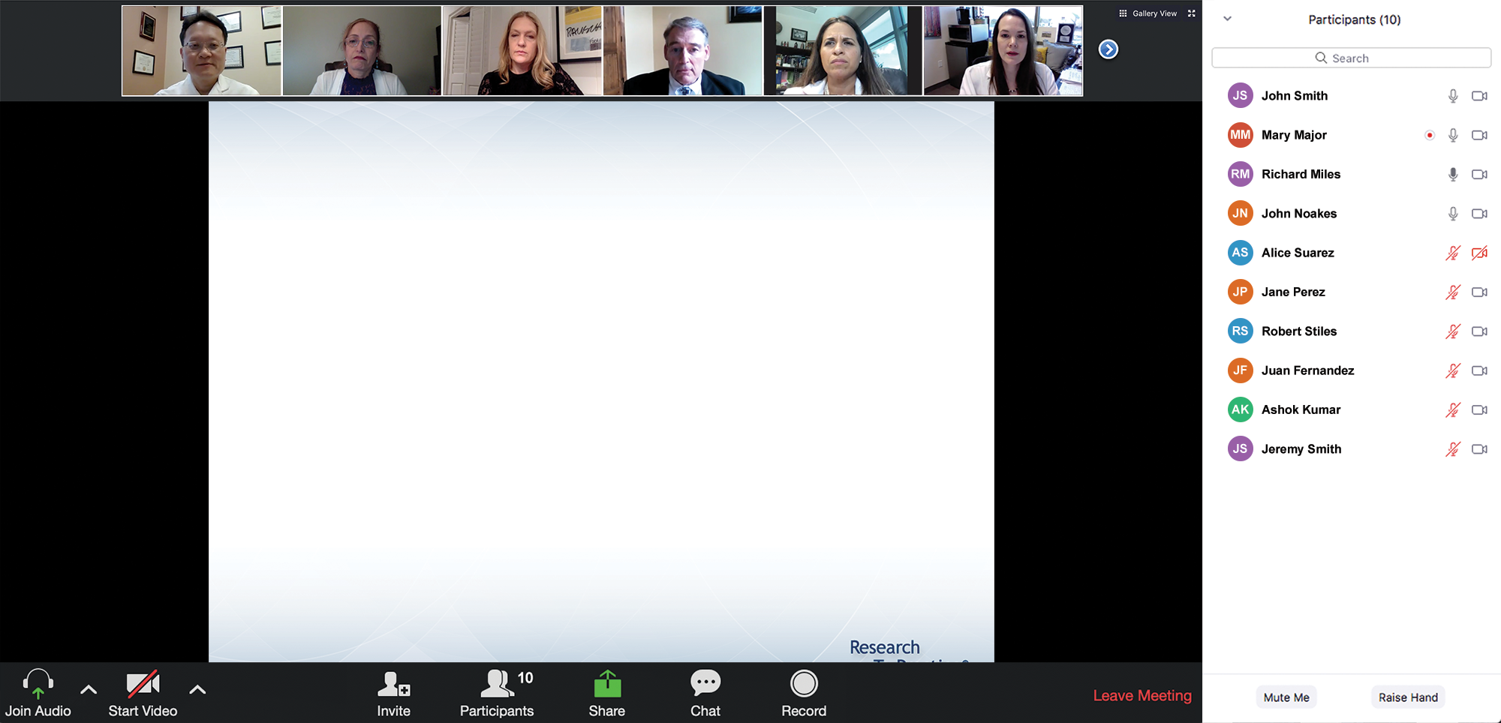
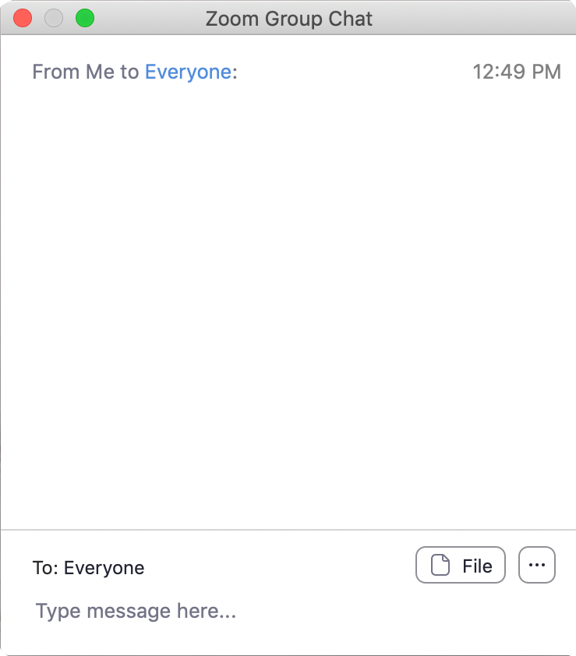
We Encourage Clinicians in Practice to Submit Questions
Feel free to submit questions now before the program begins and throughout the program.

Slide 10
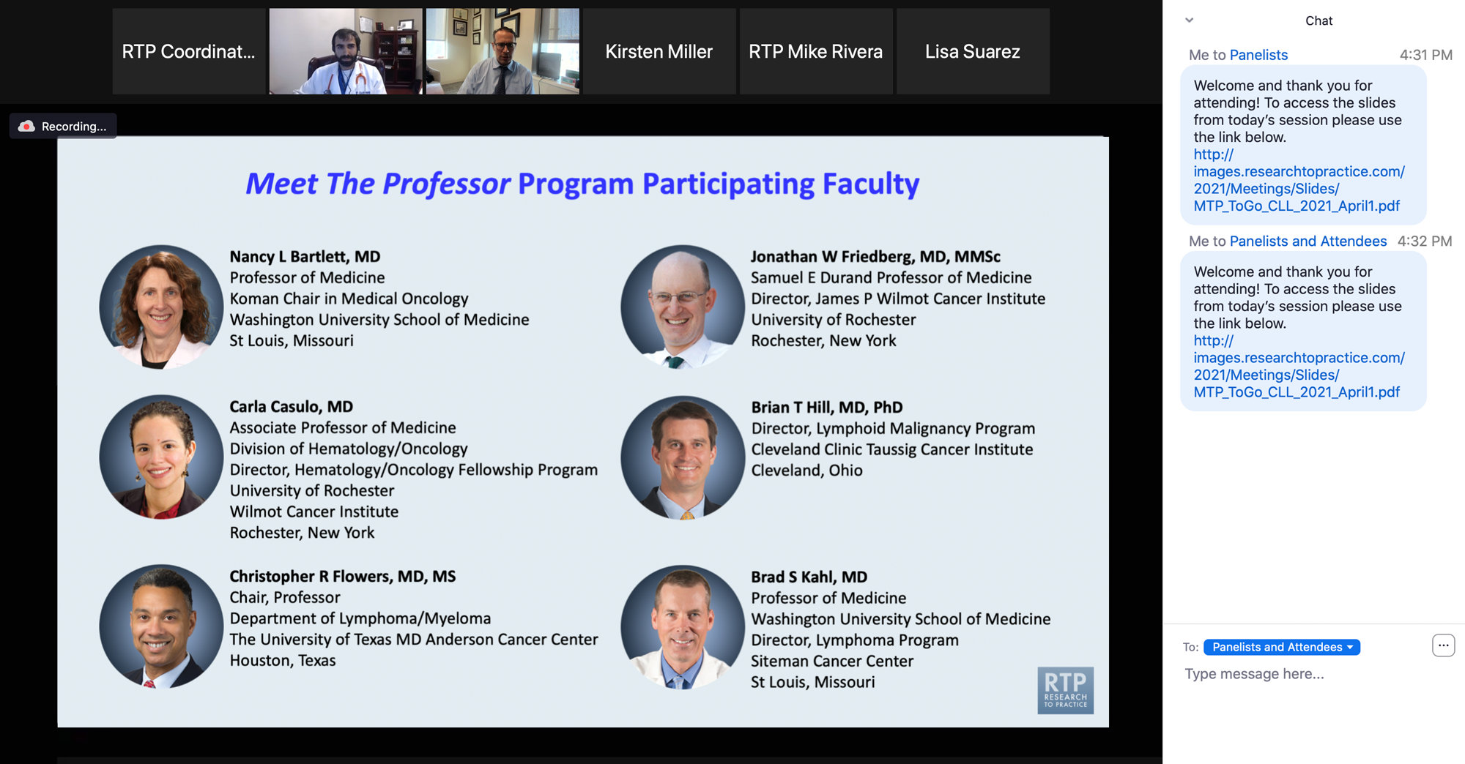
Familiarizing Yourself with the Zoom Interface
Expand chat submission box
Drag the white line above the submission box up to create more space for your message.

Slide 11
Familiarizing Yourself with the Zoom Interface
Increase chat font size
Press Command (for Mac) or Control (for PC) and the + symbol. You may do this as many times as you need for readability.

Slide 12
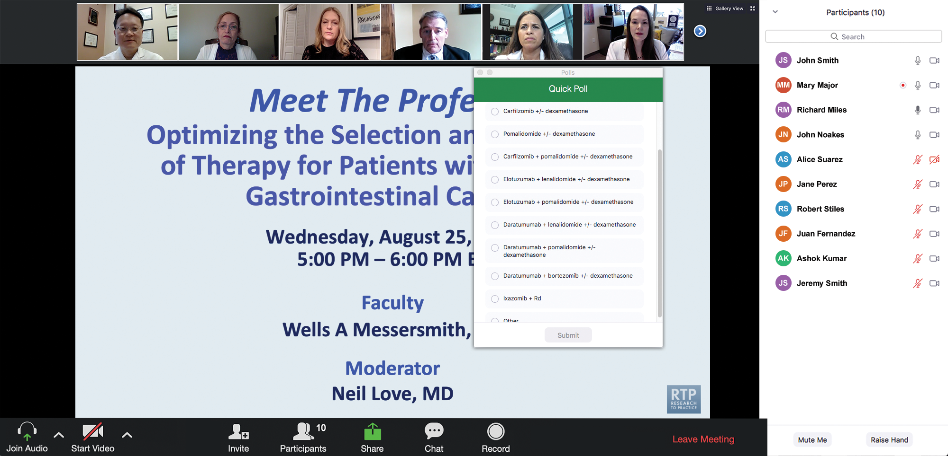
Clinicians in the Audience, Please Complete the Pre- and Postmeeting Surveys
Quick Survey
Quick Poll

Slide 14
Inside the Issue: Managing Ocular Toxicities Associated with Antibody-Drug Conjugates and Other Cancer Therapies
A CME/MOC-Accredited Live Webinar
Thursday,​ July 17, 2025 5:00 PM – 6:00 PM ET
Faculty
Rebecca A Dent, MD, MSc
Hans Lee, MD
Neel Pasricha, MD
Tiffany A Richards, PhD, ANP-BC, AOCNP
Moderator
Neil Love, MD

Slide 15
Cancer Q&A: Addressing Common Questions Posed by Patients with Relapsed/Refractory Multiple Myeloma
A Webinar Series for Clinicians and Patients, Developed in Partnership with CancerCare®
Patients
Clinicians
Wednesday, July 23, 2025
6:00 PM – 7:00 PM ET
Thursday, August 7, 2025
5:00 PM – 6:00 PM ET
Faculty
Natalie S Callander, MD
Sagar Lonial, MD, FACP
Moderator
Neil Love, MD

Slide 16
Addressing Current Knowledge and Practice Gaps in the Community — Optimizing the Use of Oral Selective Estrogen Receptor Degraders for Metastatic Breast Cancer
A CME/MOC-Accredited Live Webinar
Tuesday, July 29, 2025 5:00 PM – 6:00 PM ET
Faculty
Komal Jhaveri, MD, FACP
Virginia Kaklamani, MD, DSc
Moderator
Neil Love, MD

Slide 17
Practical Perspectives: Experts Review Actual Cases of Patients with Biliary Tract Cancers
A CME/MOC-Accredited Live Webinar
Wednesday, August 6, 2025 5:00 PM – 6:00 PM ET
Faculty
Haley Ellis, MD
James J Harding, MD
Moderator
Neil Love, MD

Slide 18
Selection and Sequencing of Therapy for Metastatic Triple-Negative Breast Cancer
A CME/MOC-Accredited Live Webinar
Thursday, August 28, 2025 5:00 PM – 6:00 PM ET
Faculty
Ana C Garrido-Castro, MD
Professor Peter Schmid, FRCP, MD, PhD
Moderator
Neil Love, MD

Slide 19
Two Exciting Events You Do Not Want to Miss
SOHO SYMPOSIUM SERIES
A 2-Part CME/MOC-, NCPD- and ACPE-Accredited Satellite Symposium Series During the Society of Hematologic Oncology 2025 Annual Meeting
Relapsed/Refractory Multiple Myeloma
Thursday, September 4, 2025
6:42 PM – 7:42 PM CT (7:42 PM – 8:42 PM ET)
Follicular Lymphoma
Friday, September 5, 2025
11:47 AM – 12:47 PM CT (12:47 PM – 1:47 PM ET)

Slide 20
Thank you for joining us! Please take a moment to complete the survey currently up on Zoom. Your feedback is very important to us. Information on how to obtain CME, ABIM MOC and ABS credit will be provided at the conclusion of the activity in the Zoom chat room. Attendees will also receive an email in 1 to 3 business days with these instructions.

Slide 21
Practical Perspectives: Experts Review Actual Cases of Patients with Small Cell Lung Cancer
A CME/MOC-Accredited Live Webinar
Wednesday, July 16, 2025 5:00 PM – 6:00 PM ET
Faculty
Stephen V Liu, MD
Charles Rudin, MD, PhD
Moderator
Neil Love, MD

Slide 22
Faculty
Stephen V Liu, MD
Associate Professor of Medicine
Georgetown University Hospital
Washington, DC
MODERATOR
Neil Love, MD Research To Practice Miami, Florida
Charles Rudin, MD, PhD
Deputy Director, MSK
Sylvia Hassenfeld Chair in Lung Cancer Research
Co-Director, Druckenmiller Center for
Lung Cancer Research
Memorial Sloan Kettering Cancer Center
Professor of Medicine
Weill Cornell Medical College
New York, New York

Slide 23
We Encourage Clinicians in Practice to Submit Questions
Feel free to submit questions now before the program begins and throughout the program.

Slide 24
Clinicians in the Audience, Please Complete the Pre- and Postmeeting Surveys
Quick Survey
Quick Poll

Slide 26
Inside the Issue: Managing Ocular Toxicities Associated with Antibody-Drug Conjugates and Other Cancer Therapies
A CME/MOC-Accredited Live Webinar
Thursday,​ July 17, 2025 5:00 PM – 6:00 PM ET
Faculty
Rebecca A Dent, MD, MSc
Hans Lee, MD
Neel Pasricha, MD
Tiffany A Richards, PhD, ANP-BC, AOCNP
Moderator
Neil Love, MD

Slide 27
Cancer Q&A: Addressing Common Questions Posed by Patients with Relapsed/Refractory Multiple Myeloma
A Webinar Series for Clinicians and Patients, Developed in Partnership with CancerCare®
Patients
Clinicians
Wednesday, July 23, 2025
6:00 PM – 7:00 PM ET
Thursday, August 7, 2025
5:00 PM – 6:00 PM ET
Faculty
Natalie S Callander, MD
Sagar Lonial, MD, FACP
Moderator
Neil Love, MD

Slide 28
Addressing Current Knowledge and Practice Gaps in the Community — Optimizing the Use of Oral Selective Estrogen Receptor Degraders for Metastatic Breast Cancer
A CME/MOC-Accredited Live Webinar
Tuesday, July 29, 2025 5:00 PM – 6:00 PM ET
Faculty
Komal Jhaveri, MD, FACP
Virginia Kaklamani, MD, DSc
Moderator
Neil Love, MD

Slide 29
Practical Perspectives: Experts Review Actual Cases of Patients with Biliary Tract Cancers
A CME/MOC-Accredited Live Webinar
Wednesday, August 6, 2025 5:00 PM – 6:00 PM ET
Faculty
Haley Ellis, MD
James J Harding, MD
Moderator
Neil Love, MD

Slide 30
Selection and Sequencing of Therapy for Metastatic Triple-Negative Breast Cancer
A CME/MOC-Accredited Live Webinar
Thursday, August 28, 2025 5:00 PM – 6:00 PM ET
Faculty
Ana C Garrido-Castro, MD
Professor Peter Schmid, FRCP, MD, PhD
Moderator
Neil Love, MD

Slide 31
Two Exciting Events You Do Not Want to Miss
SOHO SYMPOSIUM SERIES
A 2-Part CME/MOC-, NCPD- and ACPE-Accredited Satellite Symposium Series During the Society of Hematologic Oncology 2025 Annual Meeting
Relapsed/Refractory Multiple Myeloma
Thursday, September 4, 2025
6:42 PM – 7:42 PM CT (7:42 PM – 8:42 PM ET)
Follicular Lymphoma
Friday, September 5, 2025
11:47 AM – 12:47 PM CT (12:47 PM – 1:47 PM ET)

Slide 32
Practical Perspectives: Experts Review Actual Cases of Patients with Small Cell Lung Cancer
A CME/MOC-Accredited Live Webinar
Wednesday, July 16, 2025 5:00 PM – 6:00 PM ET
Faculty
Stephen V Liu, MD
Charles Rudin, MD, PhD
Moderator
Neil Love, MD

Slide 33
Dr Liu — Disclosures
Advisory Committees | AstraZeneca Pharmaceuticals LP, Daiichi Sankyo Inc,Genentech, a member of the Roche Group, Gilead Sciences Inc, Jazz Pharmaceuticals Inc, Johnson & Johnson
Consulting Agreements | AbbVie Inc, Amgen Inc, AstraZeneca Pharmaceuticals LP, Boehringer Ingelheim Pharmaceuticals Inc, Bristol Myers Squibb, Daiichi Sankyo Inc, Genentech, a member of the Roche Group, Gilead Sciences Inc, GSK, Guardant Health, Jazz Pharmaceuticals Inc, Johnson & Johnson, Lilly, Merck, Merus, Mirati Therapeutics Inc, Natera Inc, Novartis, OSE Immunotherapeutics, Pfizer Inc, Regeneron Pharmaceuticals Inc, Revolution Medicines, Takeda Pharmaceuticals USA Inc, Yuhan Corporation
Contracted Research | AbbVie Inc, Alkermes, AstraZeneca Pharmaceuticals LP, Bristol Myers Squibb, Cogent Biosciences, Duality Biologics, Elevation Oncology, Ellipses Pharma, Genentech, a member of the Roche Group, Gilead Sciences Inc, Merck, Merus, Nuvalent, OSE Immunotherapeutics, Puma Biotechnology Inc, RAPT Therapeutics, Synthekine, SystImmune Inc

Slide 34
Dr Rudin — Disclosures
Consulting Agreements | AbbVie Inc, Amgen Inc, Daiichi Sankyo Inc, Genentech, a member of the Roche Group, Jazz Pharmaceuticals Inc, Novartis

Slide 35
Dr Love — Disclosures
Dr Love is president and CEO of Research To Practice. Research To Practice receives funds in the form of educational grants to develop CME activities from the following companies: Aadi Bioscience, AbbVie Inc, ADC Therapeutics, Alexion Pharmaceuticals, Amgen Inc, Array BioPharma Inc, a subsidiary of Pfizer Inc, Arvinas, Astellas, AstraZeneca Pharmaceuticals LP, Aveo Pharmaceuticals, Bayer HealthCare Pharmaceuticals, BeOne, Black Diamond Therapeutics Inc, Blueprint Medicines, Boehringer Ingelheim Pharmaceuticals Inc, Bristol Myers Squibb, Clovis Oncology, Coherus BioSciences, CTI BioPharma, a Sobi Company, Daiichi Sankyo Inc, Eisai Inc, Elevation Oncology Inc, Exact Sciences Corporation, Exelixis Inc, Genentech, a member of the Roche Group, Genmab US Inc, Geron Corporation, Gilead Sciences Inc, GSK, Hologic Inc, ImmunoGen Inc, Incyte Corporation, Ipsen Biopharmaceuticals Inc, Jazz Pharmaceuticals Inc, Johnson & Johnson, Karyopharm Therapeutics, Kite, A Gilead Company, Kura Oncology, Legend Biotech, Lilly, MEI Pharma Inc, Merck, Mersana Therapeutics Inc, Mirati Therapeutics Inc, Mural Oncology Inc, Natera Inc, Novartis, Novartis Pharmaceuticals Corporation on behalf of Advanced Accelerator Applications, Novocure Inc, Nuvalent, Pfizer Inc, Pharmacyclics LLC, an AbbVie Company, Puma Biotechnology Inc, Regeneron Pharmaceuticals Inc, Rigel Pharmaceuticals Inc, R-Pharm US, Sanofi, Seagen Inc, Servier Pharmaceuticals LLC, SpringWorks Therapeutics Inc, Stemline Therapeutics Inc, Syndax Pharmaceuticals, Taiho Oncology Inc, Takeda Pharmaceuticals USA Inc, TerSera Therapeutics LLC, and Tesaro, A GSK Company.

Slide 36
Commercial Support
This activity is supported by educational grants from AstraZeneca Pharmaceuticals LP, Daiichi Sankyo Inc, Jazz Pharmaceuticals Inc, and Merck.
Research To Practice CME Planning Committee Members, Staff and Reviewers
Planners, scientific staff and independent reviewers for Research To Practice have no relevant conflicts of interest to disclose.

Slide 37
This educational activity contains discussion of non-FDA-approved uses of agents and regimens. Please refer to official prescribing information for each product for approved indications.

Slide 38
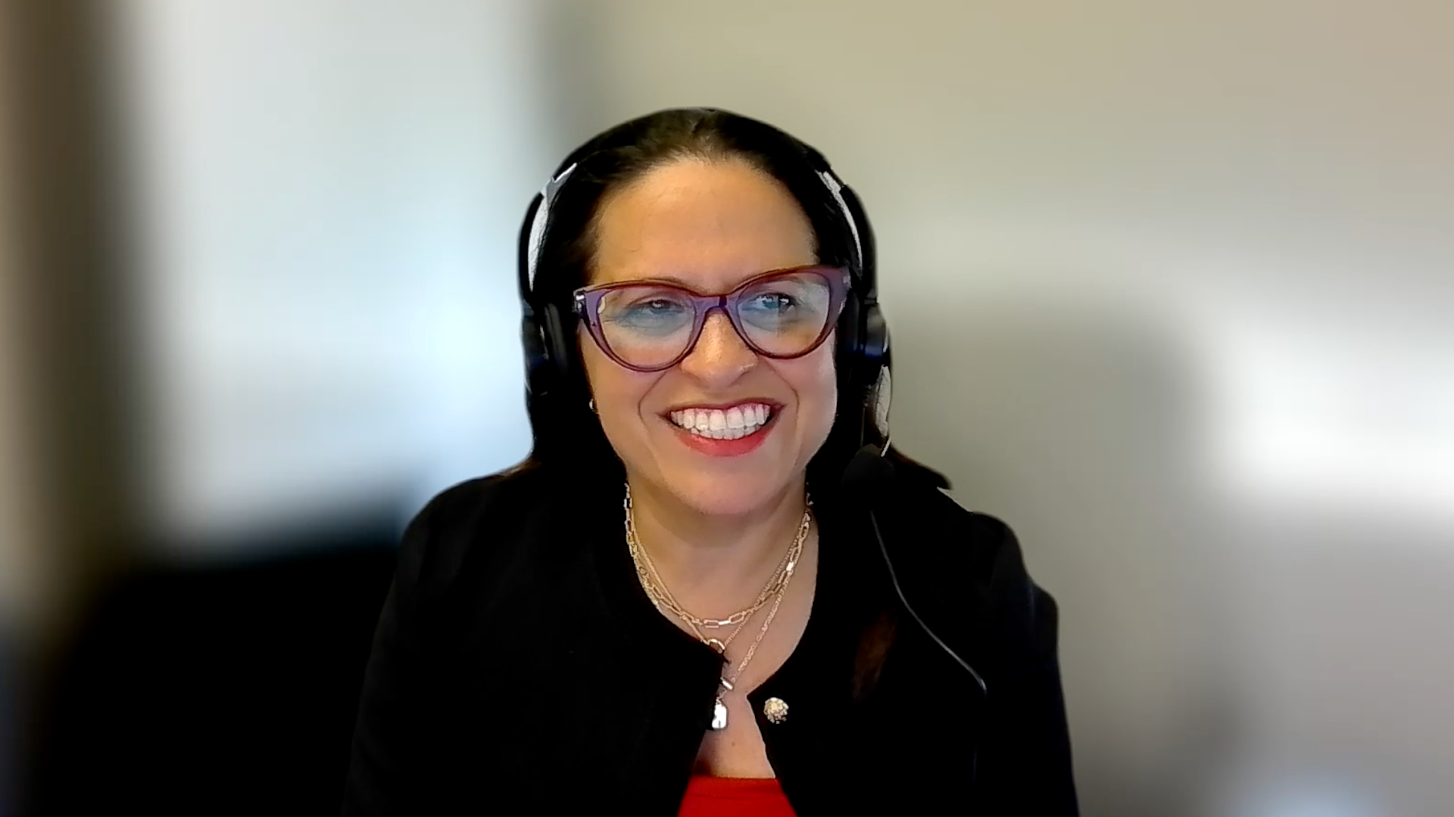
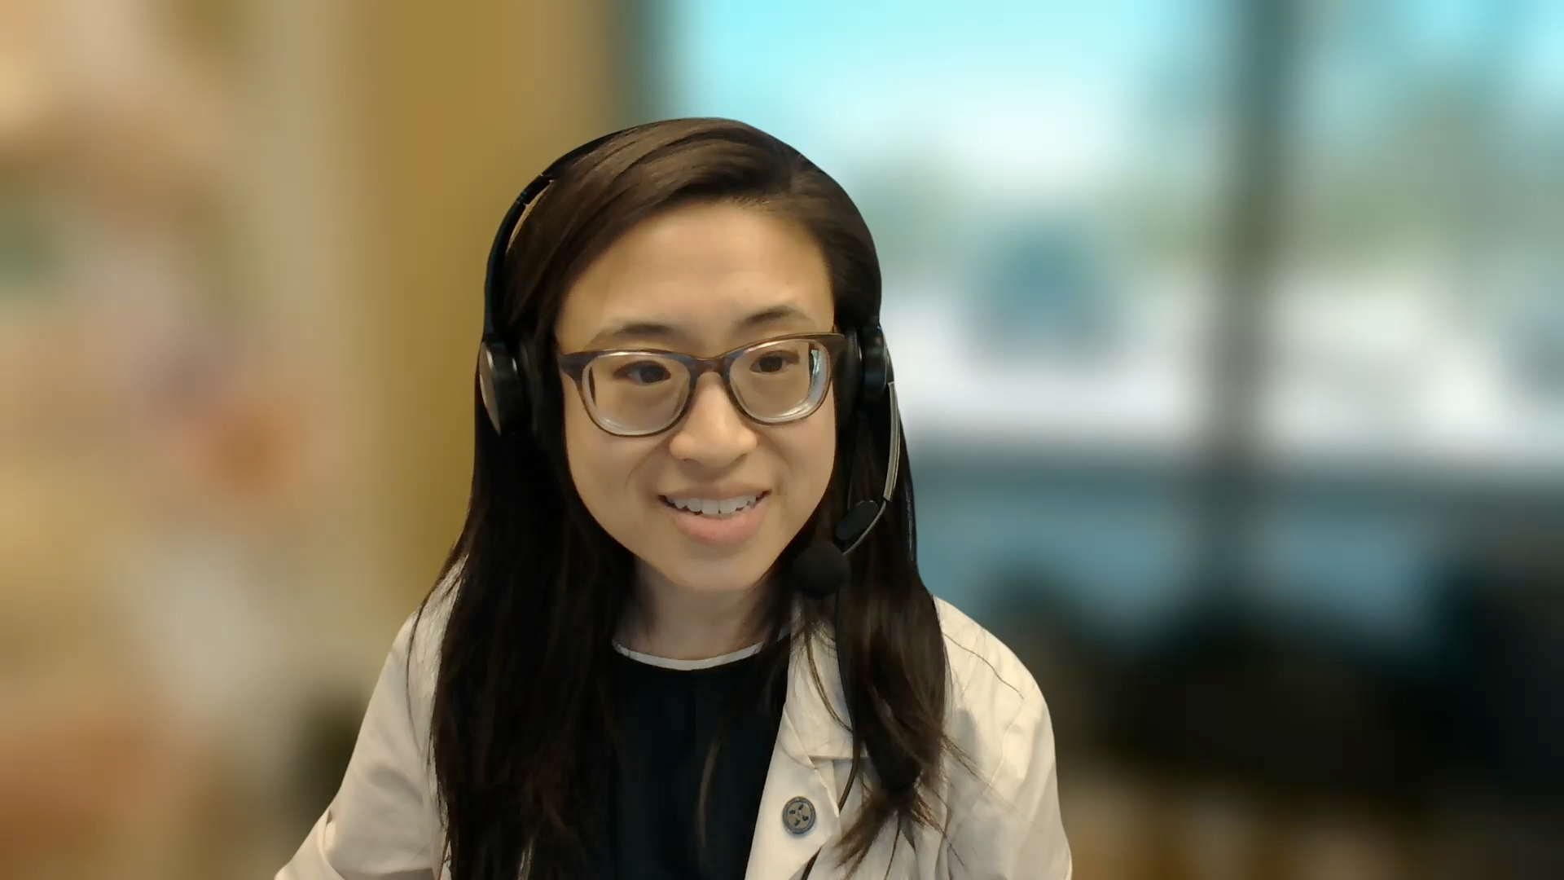
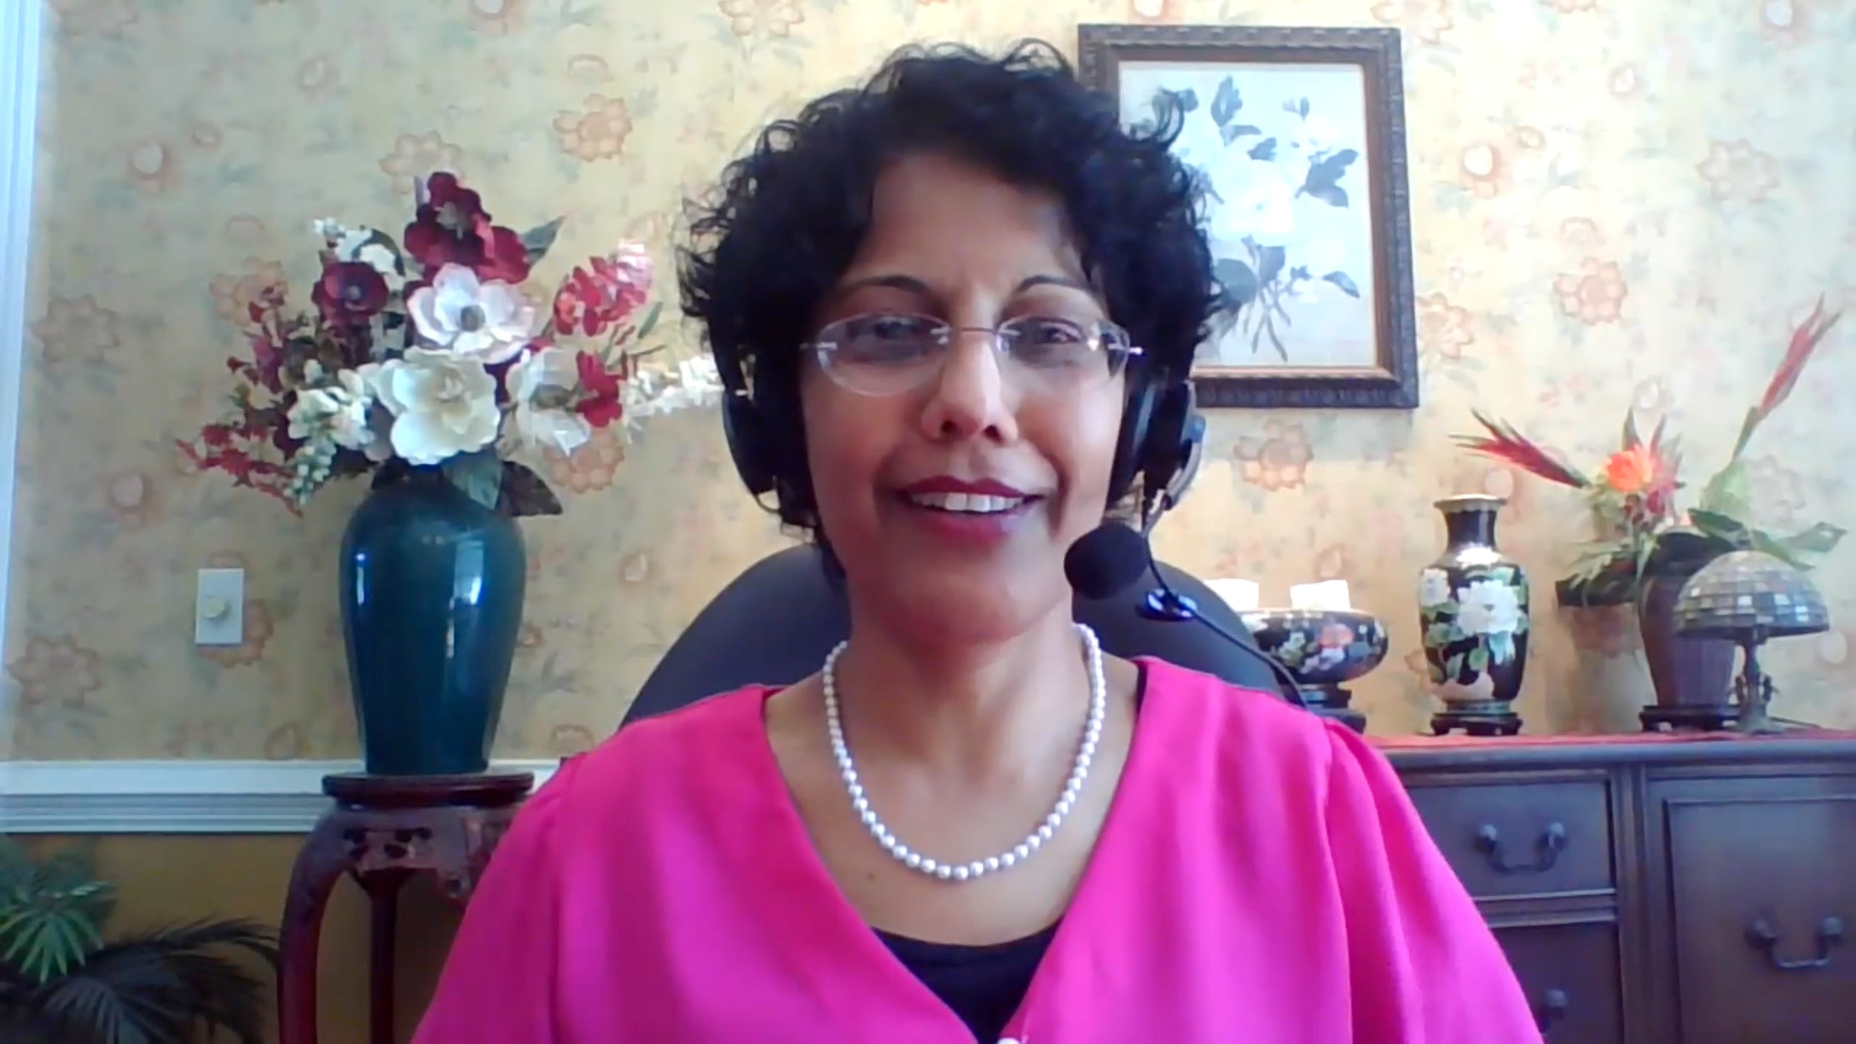
Contributing General Medical Oncologists
Ranju Gupta, MD
Lehigh Valley Topper Cancer Institute
Bethlehem, Pennsylvania
Estelamari Rodriguez, MD, MPH
Sylvester Comprehensive Cancer Center
Miami, Florida
Kimberly Ku, MD
Illinois CancerCare
Bloomington, Illinois
Priya Rudolph, MD, PhD
Georgia Cancer Specialists
Athens, Georgia

Slide 39
Agenda
Case 1: Adjuvant Systemic Therapy?
Case 2: Lambert-Eaton Syndrome and Other Paraneoplastic Syndromes
Case 3: Small Cell Transformation of EGFR-Mutant NSCLC
Case 4: Trilaciclib in Extensive-Stage Disease
Comments: ASCO and Other Recent Datasets (Part 1)
Case 5: Short DFI with Brain Mets After Chemo/RT/Durvalumab … Lurbinectedin?
Case 6: Tarlatamab After Rapid Disease Progression on Chemo/Atezolizumab
Case 7: ICANS on Tarlatamab with Brain Mets
Case 8: BiTE with Lurbinectedin on Protocol
Comments: ASCO and Other Recent Datasets (Part 2)

Slide 40
Agenda
Case 1: Adjuvant Systemic Therapy?
Case 2: Lambert-Eaton Syndrome and Other Paraneoplastic Syndromes
Case 3: Small Cell Transformation of EGFR-Mutant NSCLC
Case 4: Trilaciclib in Extensive-Stage Disease
Comments: ASCO and Other Recent Datasets (Part 1)
Case 5: Short DFI with Brain Mets After Chemo/RT/Durvalumab … Lurbinectedin?
Case 6: Tarlatamab After Rapid Disease Progression on Chemo/Atezolizumab
Case 7: ICANS on Tarlatamab with Brain Mets
Case 8: BiTE with Lurbinectedin on Protocol
Comments: ASCO and Other Recent Datasets (Part 2)

Slide 41
Case Presentation: 73-year-old man with rheumatoid arthritis and angiosarcoma of the scalp is found to have a lung nodule and undergoes resection
Dr Estelamari Rodriguez (Miami, Florida)

Slide 42
Agenda
Case 1: Adjuvant Systemic Therapy?
Case 2: Lambert-Eaton Syndrome and Other Paraneoplastic Syndromes
Case 3: Small Cell Transformation of EGFR-Mutant NSCLC
Case 4: Trilaciclib in Extensive-Stage Disease
Comments: ASCO and Other Recent Datasets (Part 1)
Case 5: Short DFI with Brain Mets After Chemo/RT/Durvalumab … Lurbinectedin?
Case 6: Tarlatamab After Rapid Disease Progression on Chemo/Atezolizumab
Case 7: ICANS on Tarlatamab with Brain Mets
Case 8: BiTE with Lurbinectedin on Protocol
Comments: ASCO and Other Recent Datasets (Part 2)

Slide 43
Case Presentation: 64-year-old woman who presents with limited-stage SCLC with Lambert-Eaton syndrome now has NED after chemoradiation but still with motor weakness
Dr Kimberly Ku (Bloomington, Illinois)

Slide 44
Agenda
Case 1: Adjuvant Systemic Therapy?
Case 2: Lambert-Eaton Syndrome and Other Paraneoplastic Syndromes
Case 3: Small Cell Transformation of EGFR-Mutant NSCLC
Case 4: Trilaciclib in Extensive-Stage Disease
Comments: ASCO and Other Recent Datasets (Part 1)
Case 5: Short DFI with Brain Mets After Chemo/RT/Durvalumab … Lurbinectedin?
Case 6: Tarlatamab After Rapid Disease Progression on Chemo/Atezolizumab
Case 7: ICANS on Tarlatamab with Brain Mets
Case 8: BiTE with Lurbinectedin on Protocol
Comments: ASCO and Other Recent Datasets (Part 2)

Slide 45
Case Presentation: 50-year-old man with metastatic EGFR exon 19 del lung adenocarcinoma receives osimertinib with progression at 11 months and small cell transformation
Dr Estelamari Rodriguez (Miami, Florida)

Slide 46
Agenda
Case 1: Adjuvant Systemic Therapy?
Case 2: Lambert-Eaton Syndrome and Other Paraneoplastic Syndromes
Case 3: Small Cell Transformation of EGFR-Mutant NSCLC
Case 4: Trilaciclib in Extensive-Stage Disease
Comments: ASCO and Other Recent Datasets (Part 1)
Case 5: Short DFI with Brain Mets After Chemo/RT/Durvalumab … Lurbinectedin?
Case 6: Tarlatamab After Rapid Disease Progression on Chemo/Atezolizumab
Case 7: ICANS on Tarlatamab with Brain Mets
Case 8: BiTE with Lurbinectedin on Protocol
Comments: ASCO and Other Recent Datasets (Part 2)

Slide 47
Case Presentation: 66-year-old woman with ES-SCLC and brain metastases receives carboplatin/etoposide/atezolizumab and preemptive trilaciclib but develops Grade 3 neutropenia
Dr Kimberly Ku (Bloomington, Illinois)

Slide 48
Agenda
Case 1: Adjuvant Systemic Therapy?
Case 2: Lambert-Eaton Syndrome and Other Paraneoplastic Syndromes
Case 3: Small Cell Transformation of EGFR-Mutant NSCLC
Case 4: Trilaciclib in Extensive-Stage Disease
Comments: ASCO and Other Recent Datasets (Part 1)
Case 5: Short DFI with Brain Mets After Chemo/RT/Durvalumab … Lurbinectedin?
Case 6: Tarlatamab After Rapid Disease Progression on Chemo/Atezolizumab
Case 7: ICANS on Tarlatamab with Brain Mets
Case 8: BiTE with Lurbinectedin on Protocol
Comments: ASCO and Other Recent Datasets (Part 2)

Slide 49
Abstract LBA8005

Slide 50
Key Takeaway Point
Grønberg BH et al. ASCO 2025;Abstract LBA8005.

Slide 51
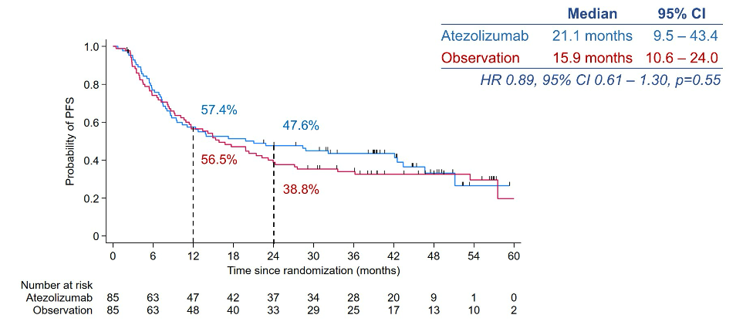
Progression-Free Survival (PFS) with Atezolizumab After Chemoradiation Therapy for LS-SCLC
Grønberg BH et al. ASCO 2025;Abstract LBA8005.

Slide 52
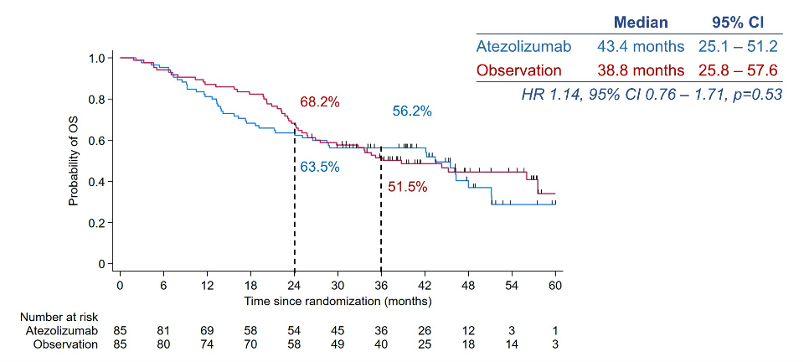
Overall Survival (OS) with Atezolizumab After Chemoradiation Therapy for LS-SCLC
Grønberg BH et al. ASCO 2025;Abstract LBA8005.

Slide 53
Phase III ADRIATIC Study Design
cCRT = concurrent platinum-based chemoradiation therapy; PCI = prophylactic cranial irradiation
Spigel DR et al. ASCO 2024;Abstract LBA5. Cheng Y et al. N Engl J Med 2024;391(14):1313-27.

Slide 54
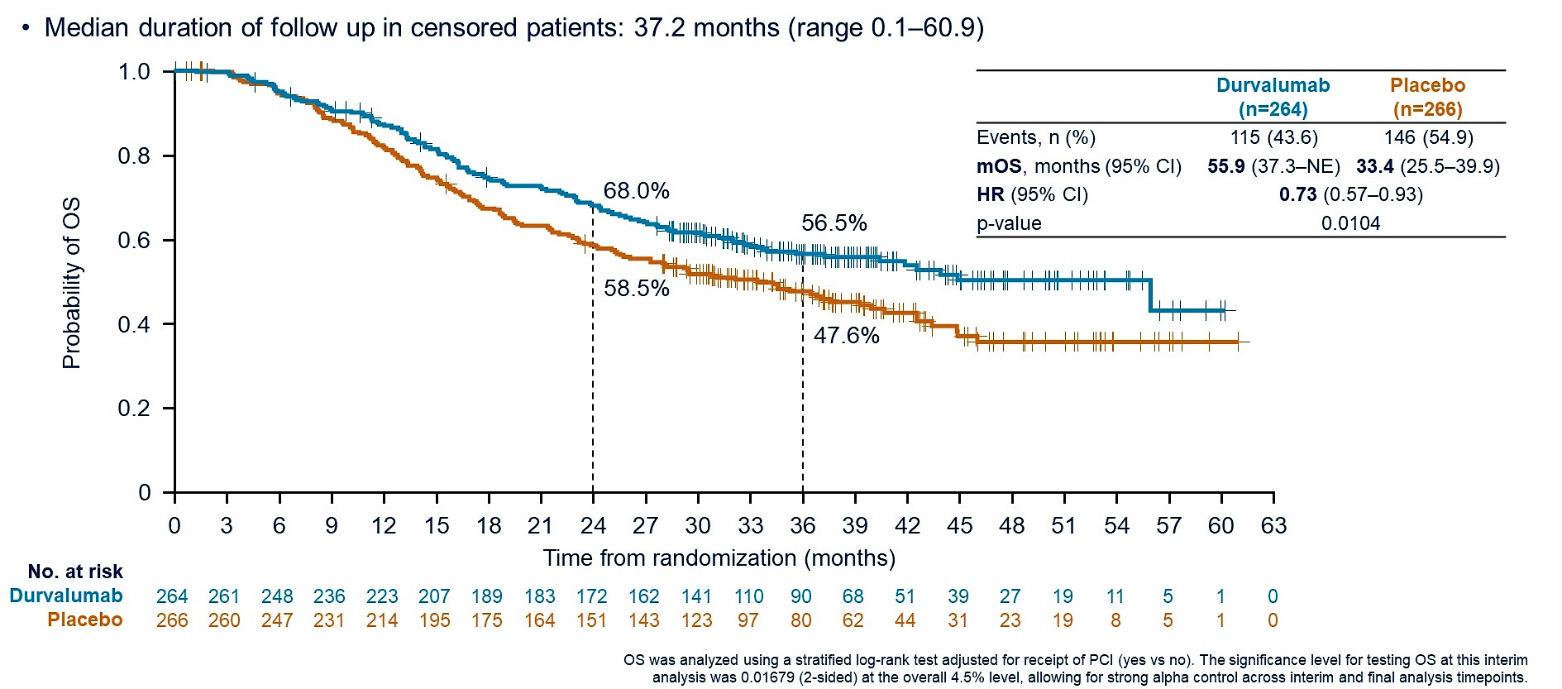
ADRIATIC: Overall Survival
Spigel DR et al. ASCO 2024;Abstract LBA5. Cheng Y et al. N Engl J Med 2024;391(14):1313-27.

Slide 55
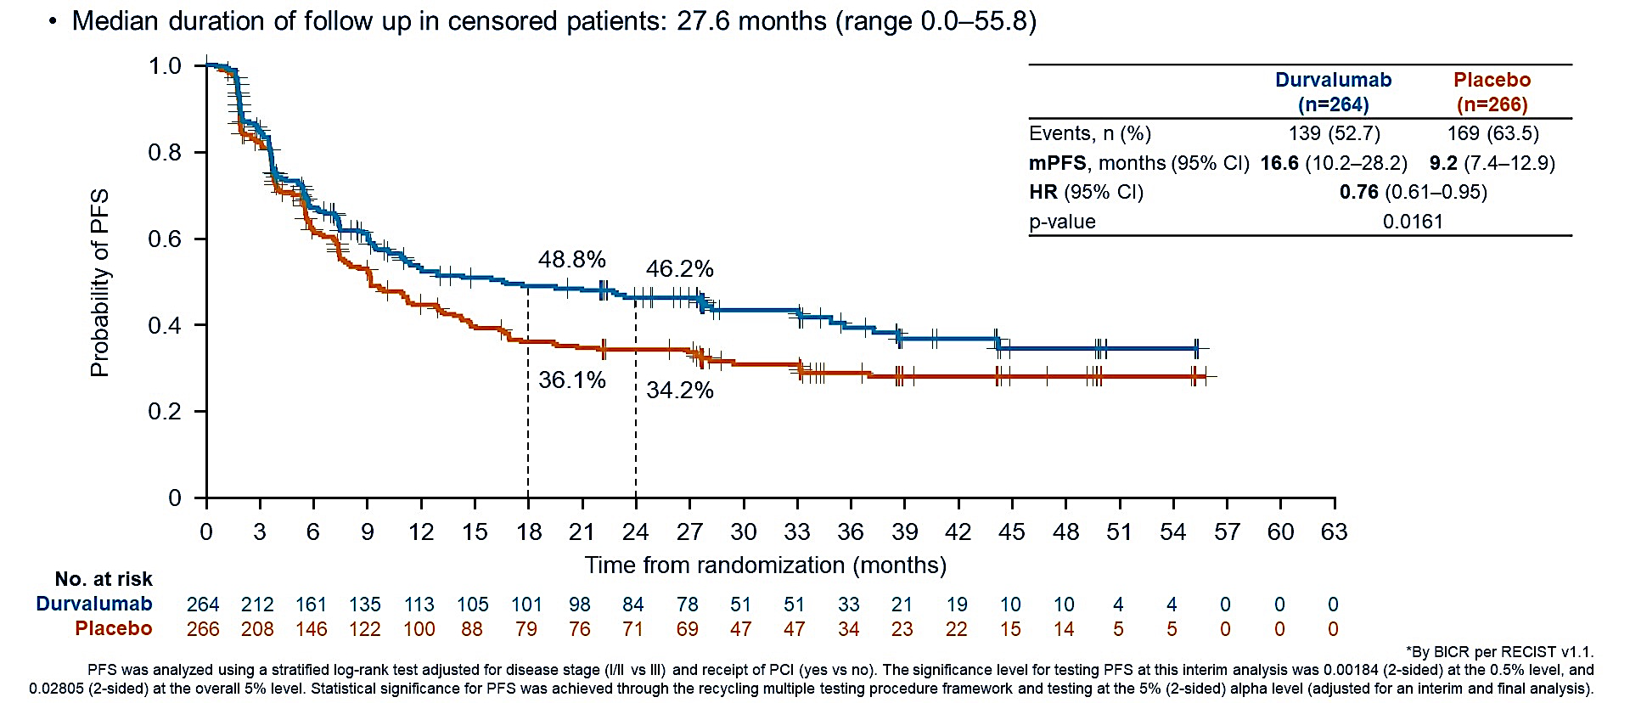
ADRIATIC: Progression-Free Survival
Spigel DR et al. ASCO 2024;Abstract LBA5. Cheng Y et al. N Engl J Med 2024;391(14):1313-27.

Slide 56
Abstract 8006

Slide 57
IMforte Study Design
CR = complete response; PR = partial response; SD = stable disease; PD = disease progression
Paz-Ares L et al. ASCO 2025;Abstract 8006. Paz-Ares L et al. Lancet 2025;405(10495):2129-43.

Slide 58
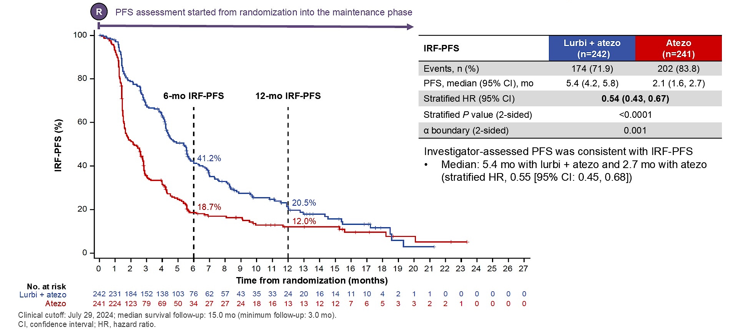
IMforte: Independent Review Facility-Assessed Progression-Free Survival (IRF-PFS) from Randomization into Maintenance Phase
Paz-Ares L et al. ASCO 2025;Abstract 8006. Paz-Ares L et al. Lancet 2025;405(10495):2129-43.

Slide 59
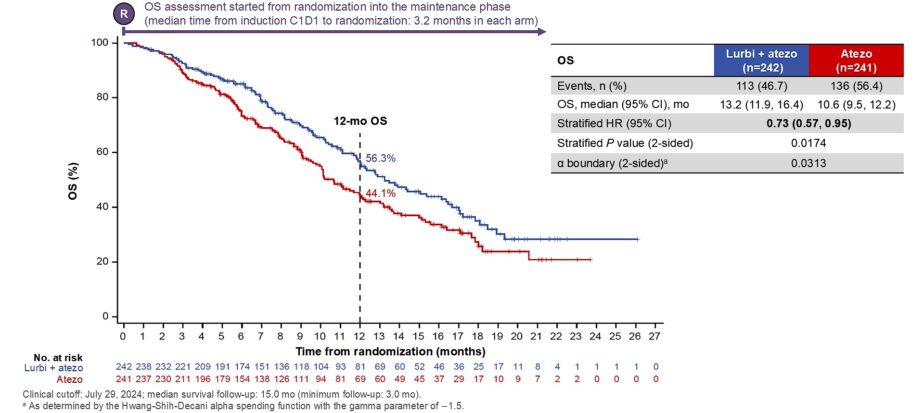
IMforte: Overall Survival (OS) from Randomization into Maintenance Phase
Paz-Ares L et al. ASCO 2025;Abstract 8006. Paz-Ares L et al. Lancet 2025;405(10495):2129-43.

Slide 60
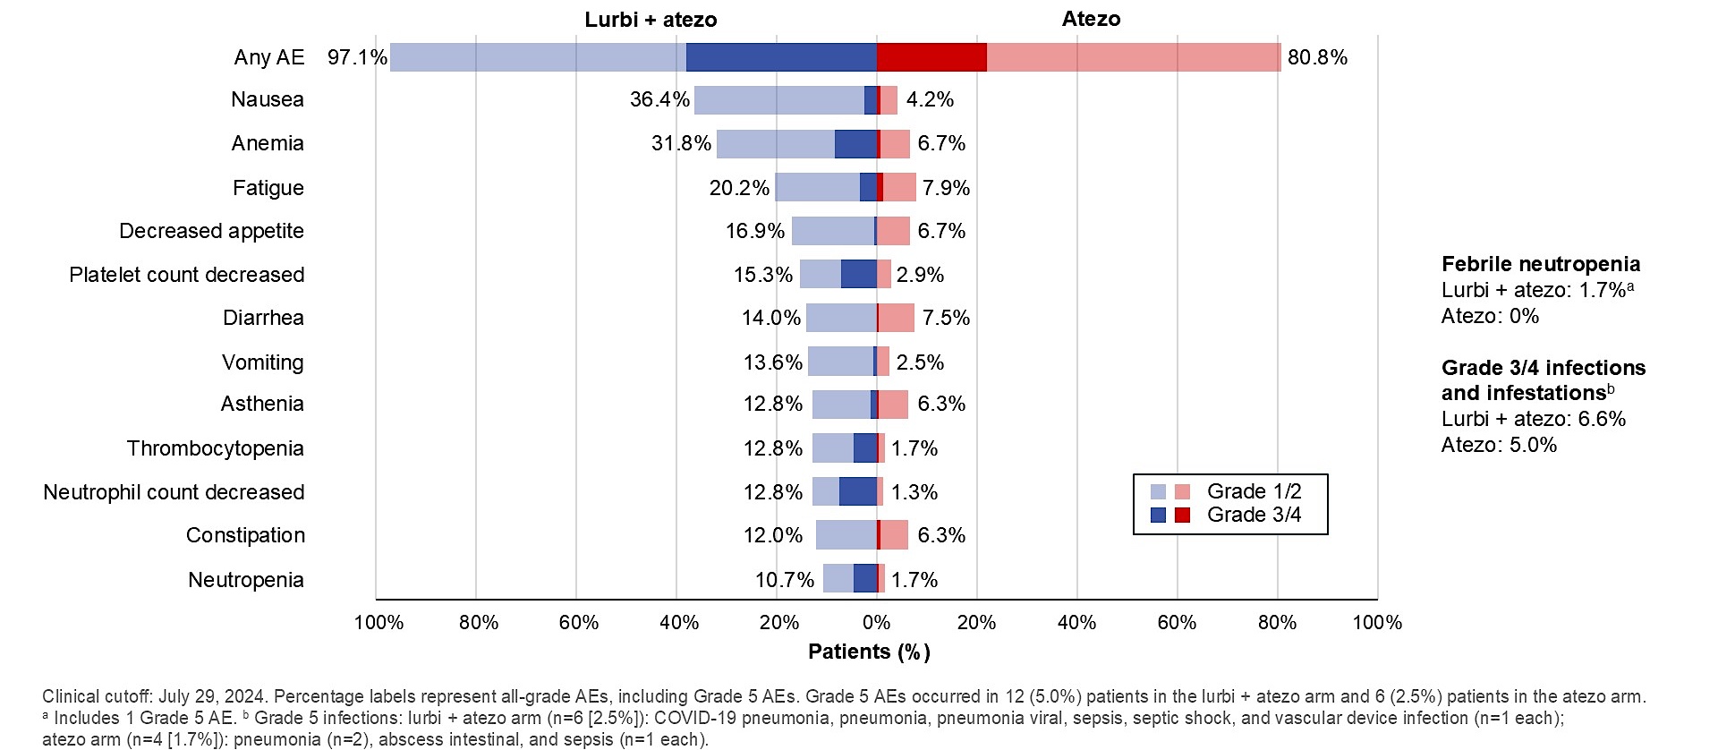
IMforte: All-Cause Adverse Events (AEs) with Incidence ≥10% in Either Arm
Paz-Ares L et al. ASCO 2025;Abstract 8006. Paz-Ares L et al. Lancet 2025;405(10495):2129-43.

Slide 61
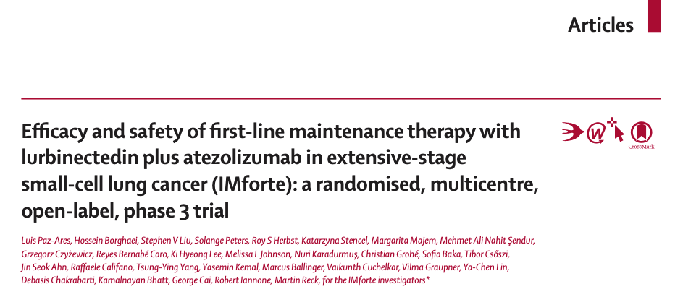
Lancet 2025;405(10495):2129-43

Slide 62
Abstract LBA8008

Slide 63
DeLLphi-304 Background
Rudin CM et al. ASCO 2025;Abstract LBA8008.

Slide 64
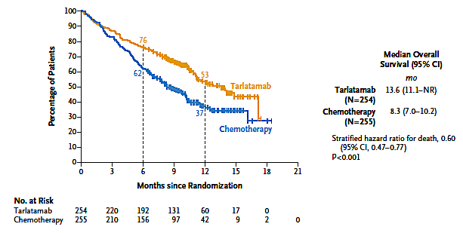
DeLLphi-304 Primary Endpoint: Overall Survival
Rudin CM et al. ASCO 2025;Abstract LBA8008; Mountzios G et al. N Engl J Med Jun 2 2025;[Online ahead of print].

Slide 65
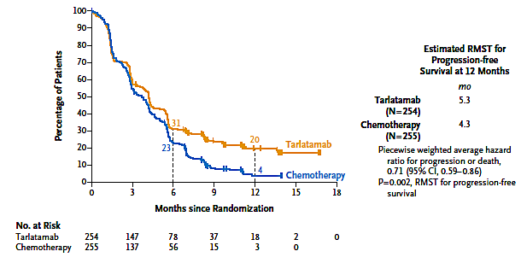
DeLLphi-304: Progression-Free Survival
RMST = restricted mean survival time
Rudin CM et al. ASCO 2025;Abstract LBA8008; Mountzios G et al. N Engl J Med Jun 2 2025;[Online ahead of print].

Slide 66
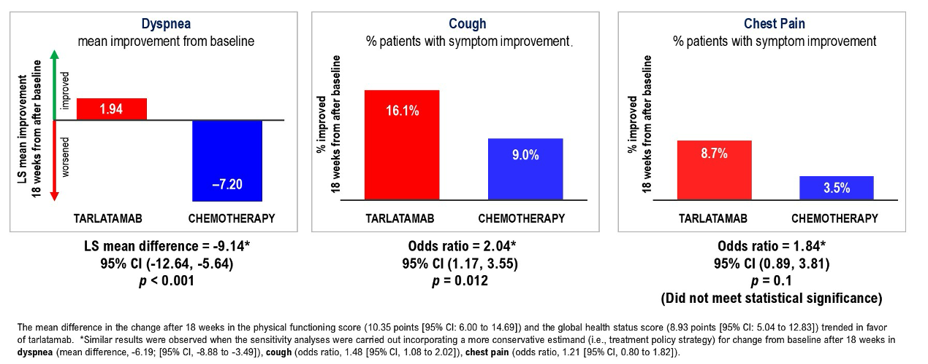
DeLLphi-304: Symptom Change from Baseline
Rudin CM et al. ASCO 2025;Abstract LBA8008.

Slide 67
DeLLphi-304: Tarlatamab Safety Profile
Rudin CM et al. ASCO 2025;Abstract LBA8008.

Slide 68
DeLLphi-304: CRS and ICANS Events
Rudin CM et al. ASCO 2025;Abstract LBA8008.

Slide 69
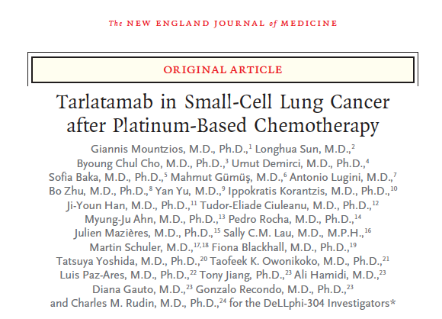
June 2, 2025;[Online ahead of print]

Slide 70
Meador CB et al. ASCO 2025;Discussant.

Slide 71
IMforte: Conclusions and Practice Implications
ICI = immune checkpoint inhibitor
Meador CB et al. ASCO 2025;Discussant.

Slide 72
Evolving Management Strategies for Cytokine Release Syndrome (CRS)
Meador CB et al. ASCO 2025;Discussant.

Slide 73
DeLLphi-304: Conclusions and Practice Implications
Meador CB et al. ASCO 2025;Discussant.

Slide 74
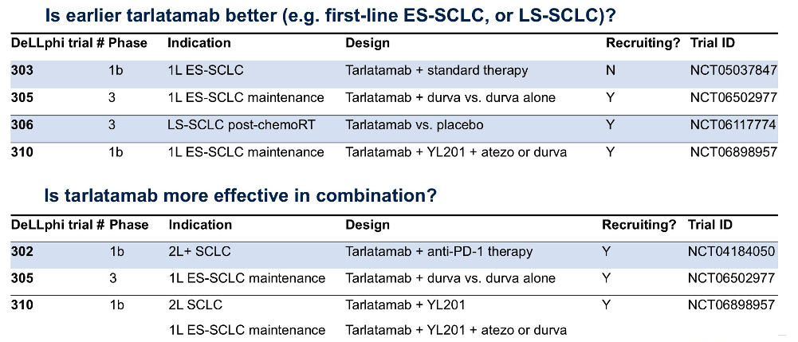
The Road Ahead: Tarlatamab
Meador CB et al. ASCO 2025;Discussant.

Slide 75
ES-SCLC: Current Treatment Landscape
Meador CB et al. ASCO 2025;Discussant.

Slide 76
Abstract 8007

Slide 77
Key Takeaway Points
Ai X et al. ASCO 2025;Abstract 8007.

Slide 78
Alveltamig Antitumor Activity as Assessed by IRC
ORR = objective response rate
Ai X et al. ASCO 2025;Abstract 8007.

Slide 79
Ifinatamab Deruxtecan (I-DXd)
Hayashi H et al. Japanese Society of Medical Oncology (JSMO) 2025;Abstract O12-4.

Slide 80
Phase II IDeate-Lung01 Study Design
Hayashi H et al. JSMO 2025;Abstract O12-4.

Slide 81
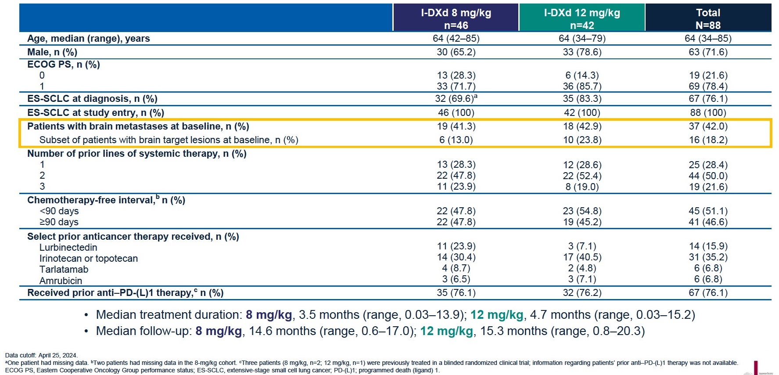
IDeate-Lung01: Baseline Characteristics
Hayashi H et al. JSMO 2025;Abstract O12-4.

Slide 82
IDeate-Lung01: Responses
Hayashi H et al. JSMO 2025;Abstract O12-4.

Slide 83
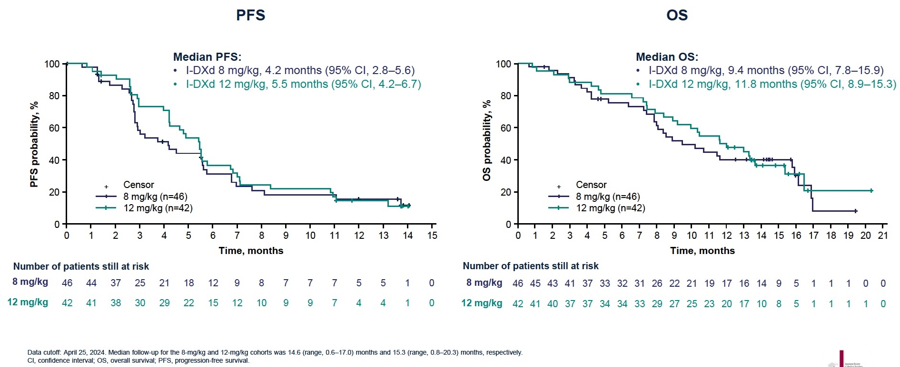
IDeate-Lung01: Survival
Hayashi H et al. JSMO 2025;Abstract O12-4.

Slide 84
IDeate-Lung01: Intracranial Activity of I-DXd
Hayashi H et al. JSMO 2025;Abstract O12-4.

Slide 85
IDeate-Lung01: Adverse Events
Hayashi H et al. JSMO 2025;Abstract O12-4.

Slide 86
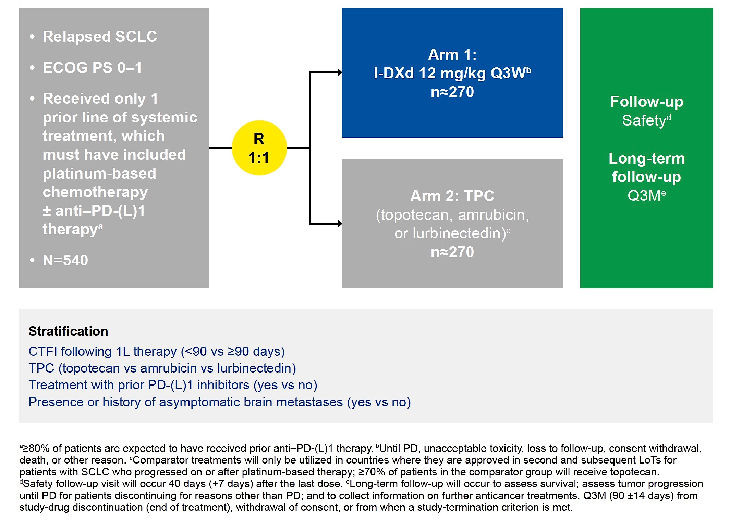
Phase III IDeate-Lung02 Study
Primary endpoints: ORR, OS
Secondary endpoints: ORR, PFS, DOR, DCR, TTR, PROs, Safety, Immunogenicity, Pharmacokinetics, Relationship between B7-H3 expression and outcomes
Hayashi H et al. JSMO 2025;Abstract P93-5.

Slide 87
Phase Ib/II IDeate-Lung03 Study
Primary endpoints: Safety (DLTs [Part A] and TEAEs [Parts A and B])
Secondary endpoints: PFS, ORR, DCR, DOR, CBR, TTR, Best percentage change in sum of diameters of measurable tumors, OS, Pharmacokinetics, Immunogenicity
Hayashi H et al. JSMO 2025;Abstract P93-6.

Slide 88
Agenda
Case 1: Adjuvant Systemic Therapy?
Case 2: Lambert-Eaton Syndrome and Other Paraneoplastic Syndromes
Case 3: Small Cell Transformation of EGFR-Mutant NSCLC
Case 4: Trilaciclib in Extensive-Stage Disease
Comments: ASCO and Other Recent Datasets (Part 1)
Case 5: Short DFI with Brain Mets After Chemo/RT/Durvalumab … Lurbinectedin?
Case 6: Tarlatamab After Rapid Disease Progression on Chemo/Atezolizumab
Case 7: ICANS on Tarlatamab with Brain Mets
Case 8: BiTE with Lurbinectedin on Protocol
Comments: ASCO and Other Recent Datasets (Part 2)

Slide 89
Case Presentation: 85-year-old man with mild dementia and LS-SCLC receives cisplatin/etoposide with RT and maintenance durvalumab but then develops worsening confusion and is found to have multiple bilateral brain metastases
Dr Priya Rudolph (Athens, Georgia)

Slide 90
Agenda
Case 1: Adjuvant Systemic Therapy?
Case 2: Lambert-Eaton Syndrome and Other Paraneoplastic Syndromes
Case 3: Small Cell Transformation of EGFR-Mutant NSCLC
Case 4: Trilaciclib in Extensive-Stage Disease
Comments: ASCO and Other Recent Datasets (Part 1)
Case 5: Short DFI with Brain Mets After Chemo/RT/Durvalumab … Lurbinectedin?
Case 6: Tarlatamab After Rapid Disease Progression on Chemo/Atezolizumab
Case 7: ICANS on Tarlatamab with Brain Mets
Case 8: BiTE with Lurbinectedin on Protocol
Comments: ASCO and Other Recent Datasets (Part 2)

Slide 91
Case Presentation: 59-year-old man with ES-SCLC and rapid PD after 4 cycles of first-line carboplatin/etoposide/ atezolizumab receives tarlatamab
Dr Ranju Gupta (Bethlehem, Pennsylvania)

Slide 92
Agenda
Case 1: Adjuvant Systemic Therapy?
Case 2: Lambert-Eaton Syndrome and Other Paraneoplastic Syndromes
Case 3: Small Cell Transformation of EGFR-Mutant NSCLC
Case 4: Trilaciclib in Extensive-Stage Disease
Comments: ASCO and Other Recent Datasets (Part 1)
Case 5: Short DFI with Brain Mets After Chemo/RT/Durvalumab … Lurbinectedin?
Case 6: Tarlatamab After Rapid Disease Progression on Chemo/Atezolizumab
Case 7: ICANS on Tarlatamab with Brain Mets
Case 8: BiTE with Lurbinectedin on Protocol
Comments: ASCO and Other Recent Datasets (Part 2)

Slide 93
Case Presentation: 66-year-old woman with ES-SCLC receives carboplatin/etoposide with atezolizumab and RT followed by maintenance atezolizumab followed on relapse by lurbinectinin followed on relapse by tarlatamab
Dr Estelamari Rodriguez (Miami, Florida)

Slide 94
Agenda
Case 1: Adjuvant Systemic Therapy?
Case 2: Lambert-Eaton Syndrome and Other Paraneoplastic Syndromes
Case 3: Small Cell Transformation of EGFR-Mutant NSCLC
Case 4: Trilaciclib in Extensive-Stage Disease
Comments: ASCO and Other Recent Datasets (Part 1)
Case 5: Short DFI with Brain Mets After Chemo/RT/Durvalumab … Lurbinectedin?
Case 6: Tarlatamab After Rapid Disease Progression on Chemo/Atezolizumab
Case 7: ICANS on Tarlatamab with Brain Mets
Case 8: BiTE with Lurbinectedin on Protocol
Comments: ASCO and Other Recent Datasets (Part 2)

Slide 95
Case Presentation: 66-year-old woman with LS-SCLC receives chemoradiation and durvalumab consolidation followed on relapse by entry on a trial of a BiTE with lurbinectedin
Dr Estelamari Rodriguez (Miami, Florida)

Slide 96
Agenda
Case 1: Adjuvant Systemic Therapy?
Case 2: Lambert-Eaton Syndrome and Other Paraneoplastic Syndromes
Case 3: Small Cell Transformation of EGFR-Mutant NSCLC
Case 4: Trilaciclib in Extensive-Stage Disease
Comments: ASCO and Other Recent Datasets (Part 1)
Case 5: Short DFI with Brain Mets After Chemo/RT/Durvalumab … Lurbinectedin?
Case 6: Tarlatamab After Rapid Disease Progression on Chemo/Atezolizumab
Case 7: ICANS on Tarlatamab with Brain Mets
Case 8: BiTE with Lurbinectedin on Protocol
Comments: ASCO and Other Recent Datasets (Part 2)

Slide 97
Relapsed SCLC: The Phase I/II LUPER Study
Calles A et al. J Thorac Onc 2025;20(7)969-82.

Slide 98
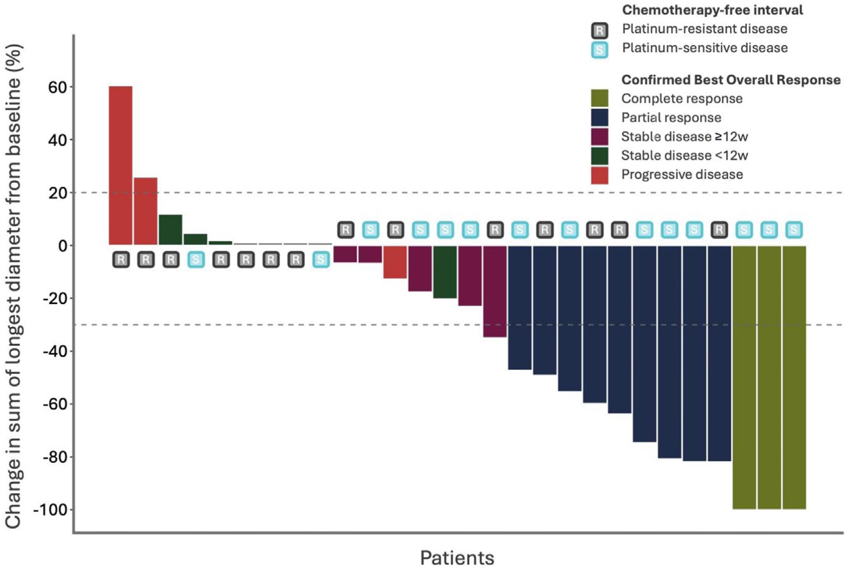
LUPER: Responses
ORR = objective response rate
Calles A et al. J Thorac Onc 2025;20(7)969-82.

Slide 99
Relapsed SCLC: The Phase III LAGOON Trial
Stratified by:
CTFI
Prior PD-L1/PD-1
LDH
CNS involvement
Investigator’s preference of the control Arm
Lurbinectedin
3.2 mg/m² IV D1 q3w
Relapsed SCLC
One prior platinum containing regimen
CTFI ≥30 days
ECOG 0-2
Adequate hematological, renal, and liver function
Treatment until progression by RECIST 1.1
Randomization
1:1:1
705 patients
Lurbinectedin 2.0 mg/m² IV D1 +
Irinotecan 75 mg/m² IV D1, 8 q3w + GCSF
Institutional choice chemotherapy
Topotecan 2.3 mg/m² oral or 1.5 mg/m² IV D1-5 q3w
Irinotecan IV 350 mg/m² D1q3w
Screening up to 28D
Treatment period
Follow-up period
Primary endpoint: Overall survival
Secondary: PFS, ORR, DoR, Safety, PRO
CTFI = chemotherapy-free interval
Besse B et al. ASCO 2023;Abstract TPS8613.

Slide 100
Abstract 8013

Slide 101
2SMALL Phase II Trial Design
Aix SP et al. ASCO 2025;Abstract 8013.

Slide 102
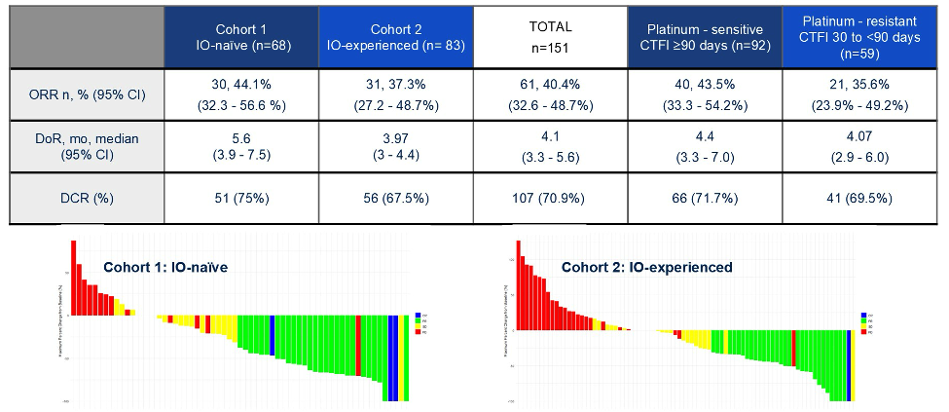
2SMALL: Efficacy
(32.3 - 56.6%)
IO = immunotherapy; CTFI = chemotherapy-free interval; ORR = objective response rate; DoR = duration of response; DCR = disease control rate
Aix SP et al. ASCO 2025;Abstract 8013.

Slide 103
Updated Analysis from NEJ045A Study: Safety and Efficacy of Durvalumab plus Carboplatin and Etoposide for Previously Untreated Extensive-Stage Small-Cell Lung Cancer Patients with a Poor Performance Status
Asao T et al.
ASCO 2025;Abstract 8557 (Poster).

Slide 104
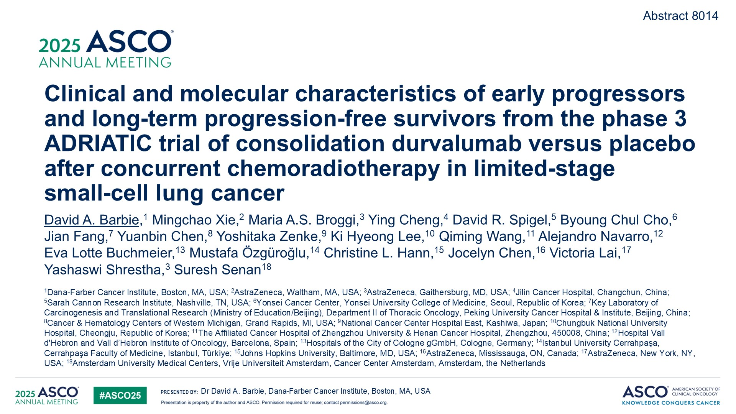

Slide 105
Multi-omic Analysis and Overall Survival Update of Phase II TRIDENT Study: Durvalumab plus Olaparib in Extensive-Stage Small-Cell Lung Cancer (ES-SCLC)
Zhao Y et al.
ASCO 2025;Abstract 8101 (Poster).

Slide 106
Implementation of Tarlatamab Treatment for Small Cell Lung Cancer Using an Outpatient Care Program
Carlisle JW et al.
ASCO 2025;Abstract 8106 (Poster).

Slide 107
Inside the Issue: Managing Ocular Toxicities Associated with Antibody-Drug Conjugates and Other Cancer Therapies
A CME/MOC-Accredited Live Webinar
Thursday,​ July 17, 2025 5:00 PM – 6:00 PM ET
Faculty
Rebecca A Dent, MD, MSc
Hans Lee, MD
Neel Pasricha, MD
Tiffany A Richards, PhD, ANP-BC, AOCNP
Moderator
Neil Love, MD

Slide 108
Thank you for joining us! Please take a moment to complete the survey currently up on Zoom. Your feedback is very important to us. The survey will remain open for 5 minutes after the meeting ends. Information on how to obtain CME, ABIM MOC and ABS credit is provided in the Zoom chat room. Attendees will also receive an email in 1 to 3 business days with these instructions.

