Slide 1
Practical Perspectives: Experts Review
Actual Cases of Patients with Biliary Tract Cancers
A CME/MOC-Accredited Live Webinar
Wednesday, August 6, 2025
5:00 PM – 6:00 PM ET
Faculty
Haley Ellis, MD
James J Harding, MD
Moderator
Neil Love, MD

Slide 2

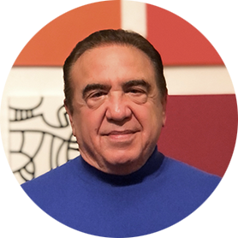

Faculty
Haley Ellis, MD
Medical Oncologist
Massachusetts General Hospital
Instructor of Medicine
Harvard Medical School
Boston, Massachusetts
MODERATOR
Neil Love, MD
Research To Practice
Miami, Florida
James J Harding, MD
Associate Attending
Memorial Sloan Kettering Cancer Center
Assistant Professor of Medicine
Weill Cornell Medical College
New York, New York

Slide 3
Commercial Support
This activity is supported by educational grants from Incyte Corporation and Jazz Pharmaceuticals Inc.

Slide 4
Dr Love — Disclosures
Dr Love is president and CEO of Research To Practice. Research To Practice receives funds in the form of educational grants to develop CME activities from the following companies: Aadi Bioscience, AbbVie Inc, ADC Therapeutics, Alexion Pharmaceuticals, Amgen Inc, Array BioPharma Inc, a subsidiary of Pfizer Inc, Arvinas, Astellas, AstraZeneca Pharmaceuticals LP, Aveo Pharmaceuticals, Bayer HealthCare Pharmaceuticals, BeOne, Black Diamond Therapeutics Inc, Blueprint Medicines, Boehringer Ingelheim Pharmaceuticals Inc, Bristol Myers Squibb, Clovis Oncology, Coherus BioSciences, CTI BioPharma, a Sobi Company, Daiichi Sankyo Inc, Eisai Inc, Elevation Oncology Inc, Exact Sciences Corporation, Exelixis Inc, Genentech, a member of the Roche Group, Genmab US Inc, Geron Corporation, Gilead Sciences Inc, GSK, Hologic Inc, ImmunoGen Inc, Incyte Corporation, Ipsen Biopharmaceuticals Inc, Jazz Pharmaceuticals Inc, Johnson & Johnson, Karyopharm Therapeutics, Kite, A Gilead Company, Kura Oncology, Legend Biotech, Lilly, MEI Pharma Inc, Merck, Mersana Therapeutics Inc, Mirati Therapeutics Inc, Mural Oncology Inc, Natera Inc, Novartis, Novartis Pharmaceuticals Corporation on behalf of Advanced Accelerator Applications, Novocure Inc, Nuvalent, Pfizer Inc, Pharmacyclics LLC, an AbbVie Company, Puma Biotechnology Inc, Regeneron Pharmaceuticals Inc, Rigel Pharmaceuticals Inc, R-Pharm US, Sanofi, Seagen Inc, Servier Pharmaceuticals LLC, SpringWorks Therapeutics Inc, Stemline Therapeutics Inc, Syndax Pharmaceuticals, Taiho Oncology Inc, Takeda Pharmaceuticals USA Inc, TerSera Therapeutics LLC, and Tesaro, A GSK Company.

Slide 5
Research To Practice CME Planning Committee Members,
Staff and Reviewers
Planners, scientific staff and independent reviewers for Research To Practice have no relevant conflicts of interest to disclose.

Slide 6
Dr Ellis — Disclosures
Advisory Committees | AstraZeneca Pharmaceuticals LP, Cogent Biosciences, Jazz Pharmaceuticals Inc
Honoraria | Incyte Corporation, Jazz Pharmaceuticals Inc
Nonrelevant Financial Relationships | Medscape, OncLive, The Jackson Laboratory

Slide 7
Dr Harding — Disclosures
Consulting Agreements | Amgen Inc, AstraZeneca Pharmaceuticals LP, Boehringer Ingelheim Pharmaceuticals Inc, Bristol Myers Squibb, Cogent Biosciences, Elevar Therapeutics, Exelixis Inc, Jazz Pharmaceuticals Inc, Merck, RayzeBio Inc, Servier Pharmaceuticals LLC
Data and Safety Monitoring Boards/Committees | Merck

Slide 8
This educational activity contains discussion of
non-FDA-approved uses of agents and regimens. Please refer to official prescribing information for each product for approved indications.

Slide 9
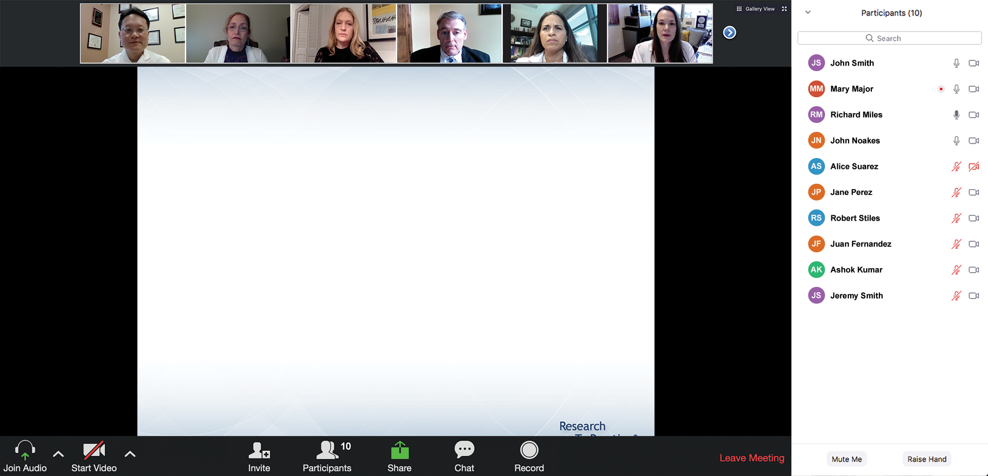

We Encourage Clinicians in Practice to Submit Questions
Feel free to submit questions now before the program begins and throughout the program.

Slide 10
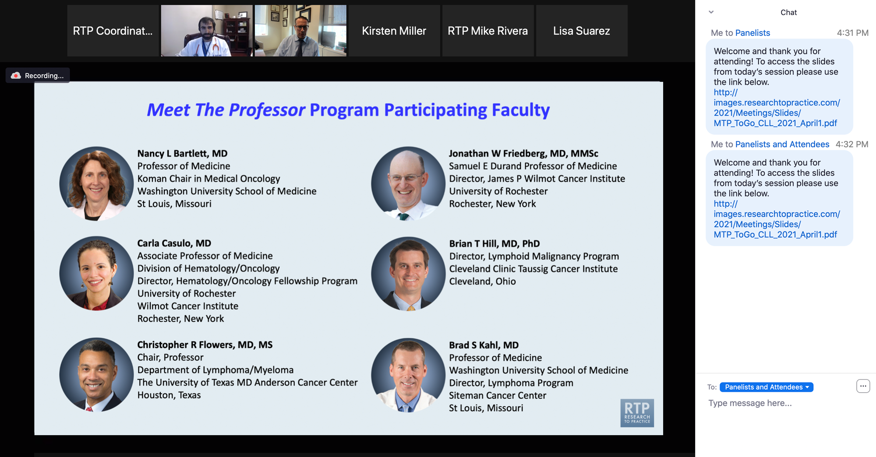
Familiarizing Yourself with the Zoom Interface
Expand chat submission box
Drag the white line above the submission box up to create
more space for your message.

Slide 11
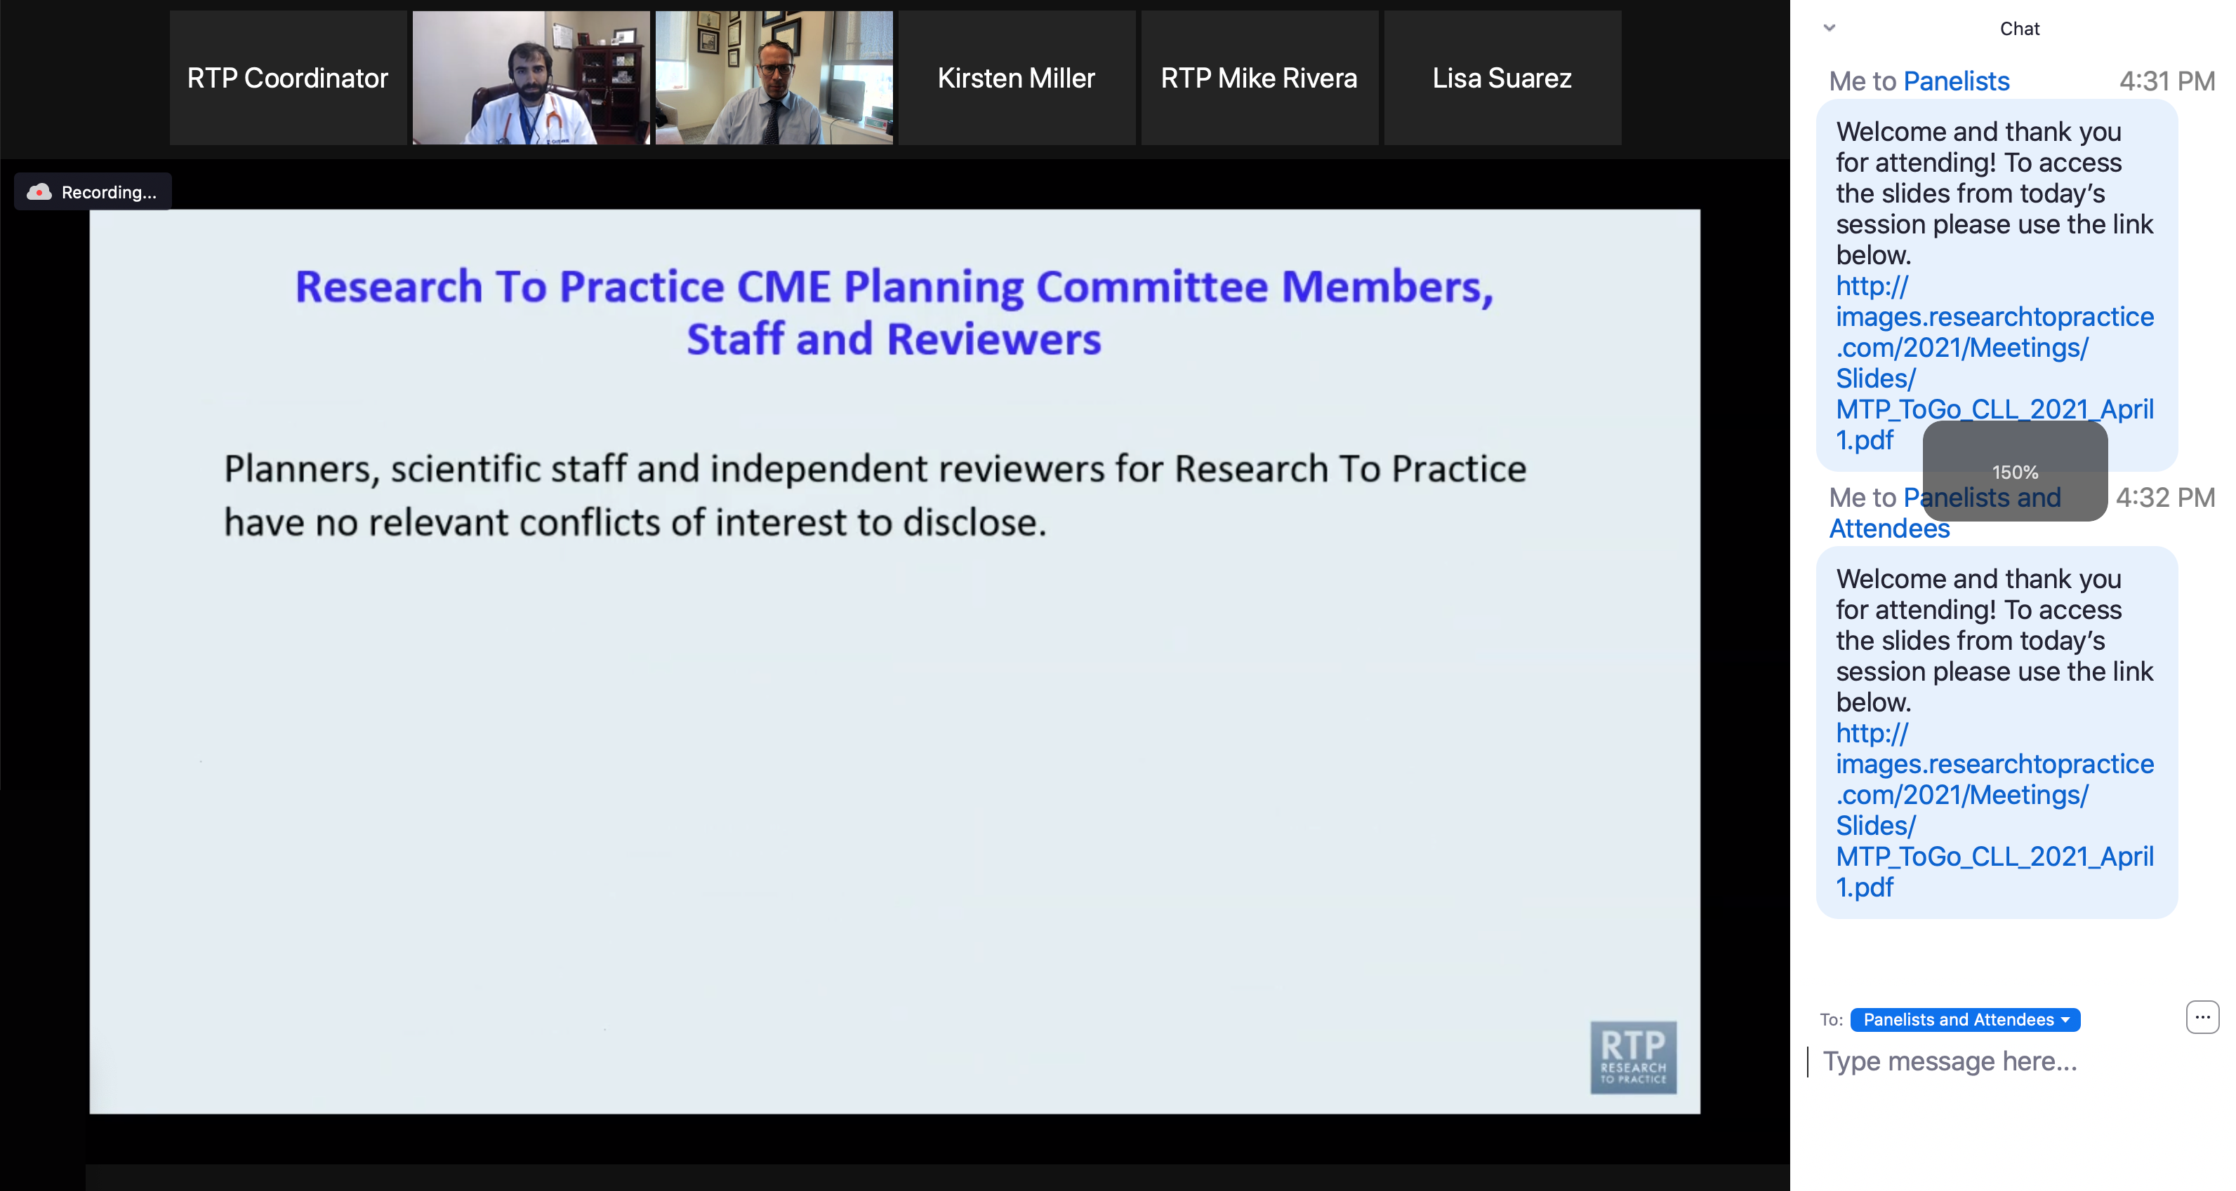
Familiarizing Yourself with the Zoom Interface
Increase chat font size
Press Command (for Mac) or Control (for PC) and the + symbol.
You may do this as many times as you need for readability.

Slide 12
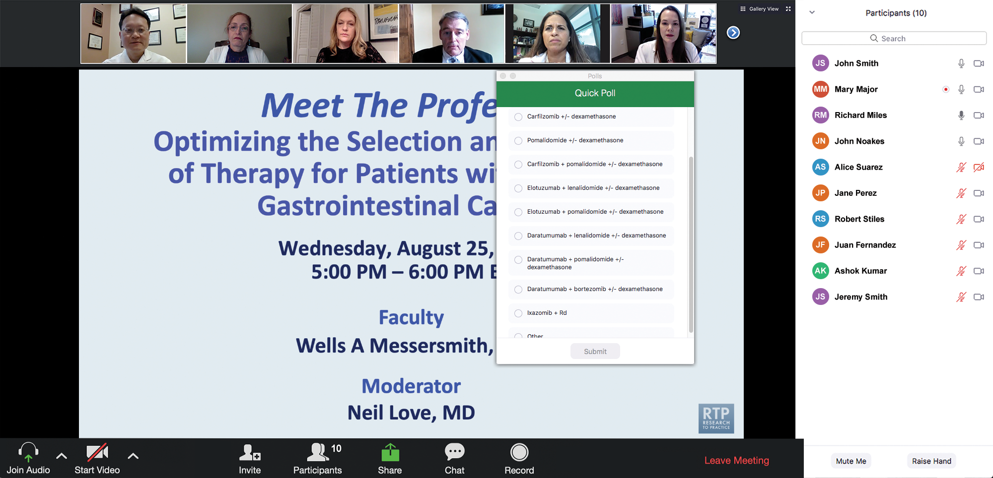
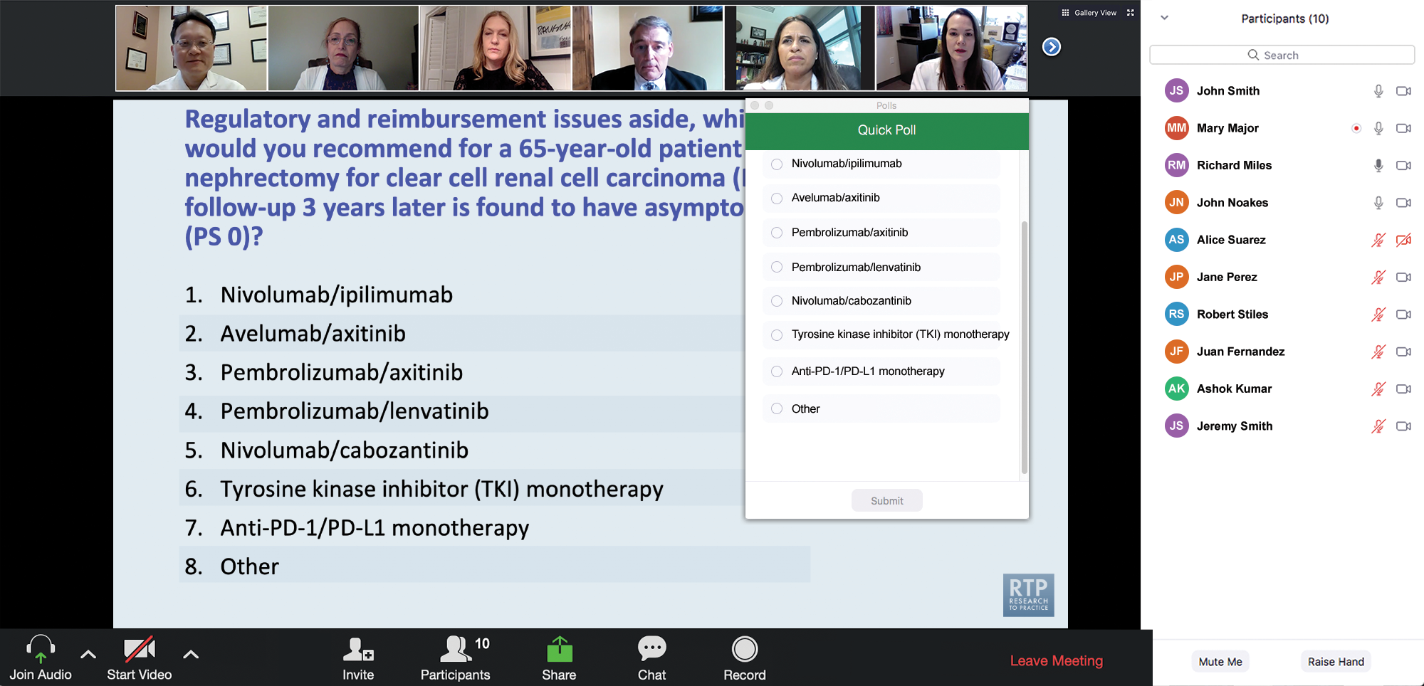
Clinicians in the Audience, Please Complete the Pre- and Postmeeting Surveys
Quick Survey
Quick Poll

Slide 13
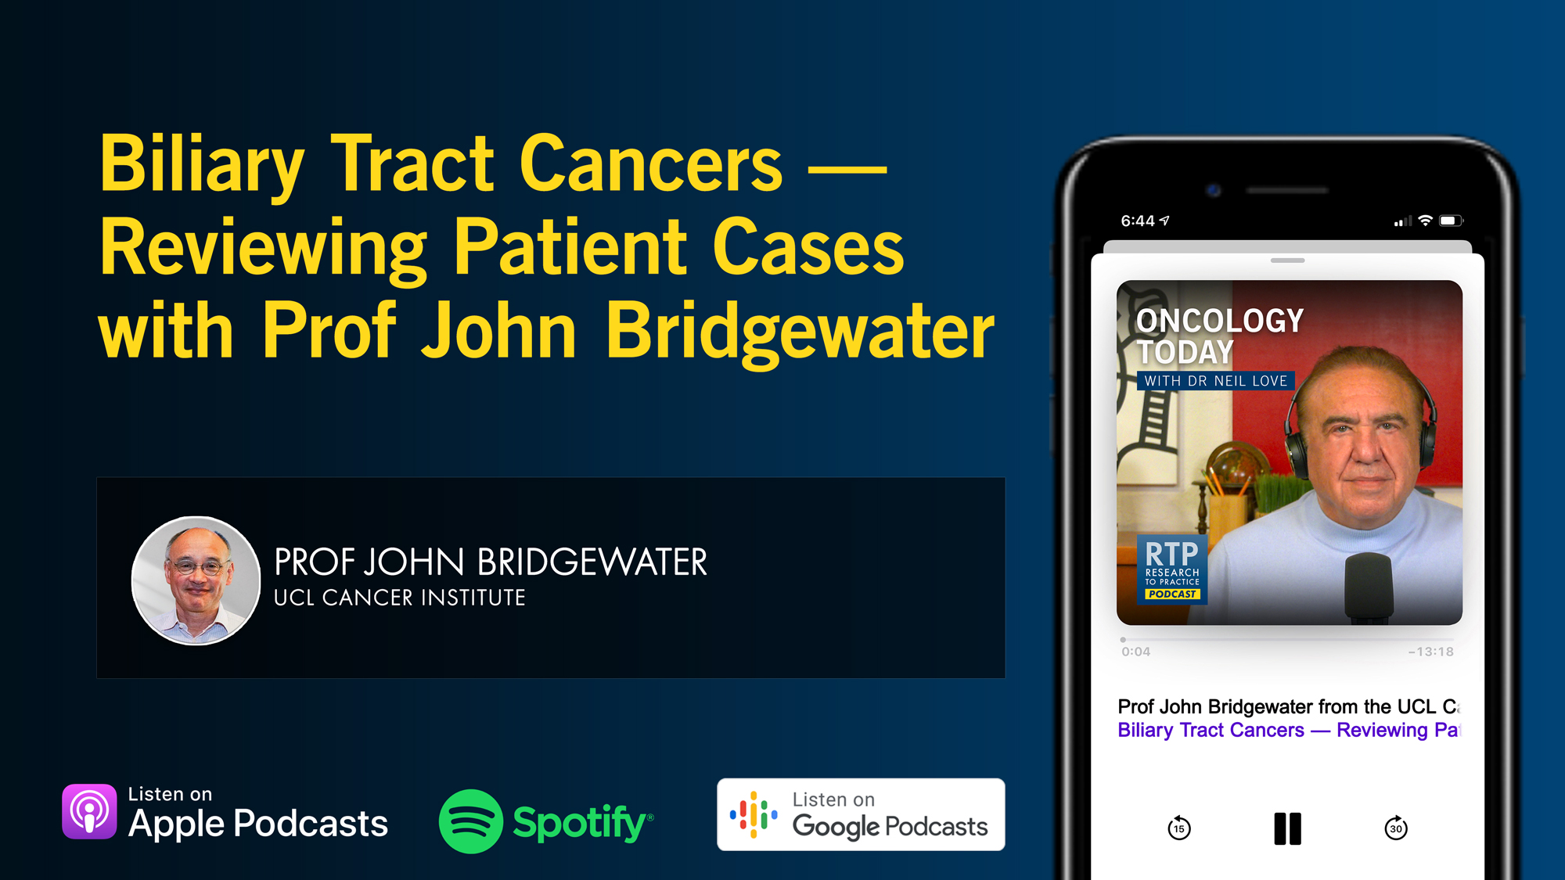

Slide 14
Cancer Q&A: Addressing Common Questions Posed by
Patients with Relapsed/Refractory Multiple Myeloma
A CME/MOC-Accredited Webinar Developed in Partnership with CancerCare®
Thursday, August 7, 2025
5:00 PM – 6:00 PM ET
Faculty
Natalie S Callander, MD
Sagar Lonial, MD, FACP
Moderator
Neil Love, MD

Slide 15
The Implications of Recent Datasets for the Current and
Future Management of Breast Cancer — An ASCO 2025 Review
A CME/MOC-Accredited Live Webinar
Wednesday, August 13, 2025
5:00 PM – 6:00 PM ET
Faculty
Sara A Hurvitz, MD, FACP
Sara M Tolaney, MD, MPH
Moderator
Neil Love, MD

Slide 16
Selection and Sequencing of Therapy for
Metastatic Triple-Negative Breast Cancer
A CME/MOC-Accredited Live Webinar
Thursday, August 28, 2025
5:00 PM – 6:00 PM ET
Faculty
Ana C Garrido-Castro, MD
Professor Peter Schmid, FRCP, MD, PhD
Moderator
Neil Love, MD

Slide 17
Consensus or Controversy? Clinical Investigators Provide Perspectives on the Current and Future Care of Patients with Relapsed/Refractory Multiple Myeloma
Part 1 of a 2-Part CME/MOC-, NCPD- and ACPE-Accredited Satellite Symposium Series During the Society of Hematologic Oncology 2025 Annual Meeting
Thursday, September 4, 2025
6:42 PM – 7:42 PM CT
Faculty
Meletios-Athanasios (Thanos) C Dimopoulos, MD
Hans Lee, MD
Noopur Raje, MD
Moderator
Joseph Mikhael, MD, MEd

Slide 18
Consensus or Controversy? Clinical Investigators
Provide Perspectives on the Current and Future Care of Patients with Follicular Lymphoma
Part 2 of a 2-Part CME/MOC-, NCPD- and ACPE-Accredited Satellite Symposium Series During the Society of Hematologic Oncology 2025 Annual Meeting
Friday, September 5, 2025
11:47 AM – 12:47 PM CT
Faculty
Jennifer Crombie, MD
Laurie H Sehn, MD, MPH
Moderator
Jeremy S Abramson, MD, MMSc

Slide 19
Addressing Current Knowledge and Practice Gaps in the Community — Optimizing the Use of Oral Selective Estrogen
Receptor Degraders for Metastatic Breast Cancer, Part 2
A CME/MOC-Accredited Live Webinar
Wednesday, October 29, 2025
5:00 PM – 6:00 PM ET
Faculty
Rinath M Jeselsohn, MD
Joyce O’Shaughnessy, MD
Moderator
Neil Love, MD

Slide 20
Thank you for joining us! Please take a moment to complete the survey currently up on Zoom.
Your feedback is very important to us.
Information on how to obtain CME, ABIM MOC and ABS credit will be provided at the conclusion of the activity in the Zoom chat room. Attendees will also receive an email in 1 to 3 business days with these instructions.

Slide 21
Practical Perspectives: Experts Review
Actual Cases of Patients with Biliary Tract Cancers
A CME/MOC-Accredited Live Webinar
Wednesday, August 6, 2025
5:00 PM – 6:00 PM ET
Faculty
Haley Ellis, MD
James J Harding, MD
Moderator
Neil Love, MD

Slide 22
Faculty
Haley Ellis, MD
Medical Oncologist
Massachusetts General Hospital
Instructor of Medicine
Harvard Medical School
Boston, Massachusetts
MODERATOR
Neil Love, MD
Research To Practice
Miami, Florida
James J Harding, MD
Associate Attending
Memorial Sloan Kettering Cancer Center
Assistant Professor of Medicine
Weill Cornell Medical College
New York, New York

Slide 23
We Encourage Clinicians in Practice to Submit Questions
Feel free to submit questions now before the program begins and throughout the program.

Slide 24
Clinicians in the Audience, Please Complete the Pre- and Postmeeting Surveys
Quick Survey
Quick Poll

Slide 26
Cancer Q&A: Addressing Common Questions Posed by
Patients with Relapsed/Refractory Multiple Myeloma
A CME/MOC-Accredited Webinar Developed in Partnership with CancerCare®
Thursday, August 7, 2025
5:00 PM – 6:00 PM ET
Faculty
Natalie S Callander, MD
Sagar Lonial, MD, FACP
Moderator
Neil Love, MD

Slide 27
The Implications of Recent Datasets for the Current and
Future Management of Breast Cancer — An ASCO 2025 Review
A CME/MOC-Accredited Live Webinar
Wednesday, August 13, 2025
5:00 PM – 6:00 PM ET
Faculty
Sara A Hurvitz, MD, FACP
Sara M Tolaney, MD, MPH
Moderator
Neil Love, MD

Slide 28
Selection and Sequencing of Therapy for
Metastatic Triple-Negative Breast Cancer
A CME/MOC-Accredited Live Webinar
Thursday, August 28, 2025
5:00 PM – 6:00 PM ET
Faculty
Ana C Garrido-Castro, MD
Professor Peter Schmid, FRCP, MD, PhD
Moderator
Neil Love, MD

Slide 29
Consensus or Controversy? Clinical Investigators Provide Perspectives on the Current and Future Care of Patients with Relapsed/Refractory Multiple Myeloma
Part 1 of a 2-Part CME/MOC-, NCPD- and ACPE-Accredited Satellite Symposium Series During the Society of Hematologic Oncology 2025 Annual Meeting
Thursday, September 4, 2025
6:42 PM – 7:42 PM CT
Faculty
Meletios-Athanasios (Thanos) C Dimopoulos, MD
Hans Lee, MD
Noopur Raje, MD
Moderator
Joseph Mikhael, MD, MEd

Slide 30
Consensus or Controversy? Clinical Investigators
Provide Perspectives on the Current and Future Care of Patients with Follicular Lymphoma
Part 2 of a 2-Part CME/MOC-, NCPD- and ACPE-Accredited Satellite Symposium Series During the Society of Hematologic Oncology 2025 Annual Meeting
Friday, September 5, 2025
11:47 AM – 12:47 PM CT
Faculty
Jennifer Crombie, MD
Laurie H Sehn, MD, MPH
Moderator
Jeremy S Abramson, MD, MMSc

Slide 31
Addressing Current Knowledge and Practice Gaps in the Community — Optimizing the Use of Oral Selective Estrogen
Receptor Degraders for Metastatic Breast Cancer, Part 2
A CME/MOC-Accredited Live Webinar
Wednesday, October 29, 2025
5:00 PM – 6:00 PM ET
Faculty
Rinath M Jeselsohn, MD
Joyce O’Shaughnessy, MD
Moderator
Neil Love, MD

Slide 32
Practical Perspectives: Experts Review
Actual Cases of Patients with Biliary Tract Cancers
A CME/MOC-Accredited Live Webinar
Wednesday, August 6, 2025
5:00 PM – 6:00 PM ET
Faculty
Haley Ellis, MD
James J Harding, MD
Moderator
Neil Love, MD

Slide 33
Dr Ellis — Disclosures
Advisory Committees | AstraZeneca Pharmaceuticals LP, Cogent Biosciences, Jazz Pharmaceuticals Inc
Honoraria | Incyte Corporation, Jazz Pharmaceuticals Inc
Nonrelevant Financial Relationships | Medscape, OncLive, The Jackson Laboratory

Slide 34
Dr Harding — Disclosures
Consulting Agreements | Amgen Inc, AstraZeneca Pharmaceuticals LP, Boehringer Ingelheim Pharmaceuticals Inc, Bristol Myers Squibb, Cogent Biosciences, Elevar Therapeutics, Exelixis Inc, Jazz Pharmaceuticals Inc, Merck, RayzeBio Inc, Servier Pharmaceuticals LLC
Data and Safety Monitoring Boards/Committees | Merck

Slide 35
Dr Love — Disclosures
Dr Love is president and CEO of Research To Practice. Research To Practice receives funds in the form of educational grants to develop CME activities from the following companies: Aadi Bioscience, AbbVie Inc, ADC Therapeutics, Alexion Pharmaceuticals, Amgen Inc, Array BioPharma Inc, a subsidiary of Pfizer Inc, Arvinas, Astellas, AstraZeneca Pharmaceuticals LP, Aveo Pharmaceuticals, Bayer HealthCare Pharmaceuticals, BeOne, Black Diamond Therapeutics Inc, Blueprint Medicines, Boehringer Ingelheim Pharmaceuticals Inc, Bristol Myers Squibb, Clovis Oncology, Coherus BioSciences, CTI BioPharma, a Sobi Company, Daiichi Sankyo Inc, Eisai Inc, Elevation Oncology Inc, Exact Sciences Corporation, Exelixis Inc, Genentech, a member of the Roche Group, Genmab US Inc, Geron Corporation, Gilead Sciences Inc, GSK, Hologic Inc, ImmunoGen Inc, Incyte Corporation, Ipsen Biopharmaceuticals Inc, Jazz Pharmaceuticals Inc, Johnson & Johnson, Karyopharm Therapeutics, Kite, A Gilead Company, Kura Oncology, Legend Biotech, Lilly, MEI Pharma Inc, Merck, Mersana Therapeutics Inc, Mirati Therapeutics Inc, Mural Oncology Inc, Natera Inc, Novartis, Novartis Pharmaceuticals Corporation on behalf of Advanced Accelerator Applications, Novocure Inc, Nuvalent, Pfizer Inc, Pharmacyclics LLC, an AbbVie Company, Puma Biotechnology Inc, Regeneron Pharmaceuticals Inc, Rigel Pharmaceuticals Inc, R-Pharm US, Sanofi, Seagen Inc, Servier Pharmaceuticals LLC, SpringWorks Therapeutics Inc, Stemline Therapeutics Inc, Syndax Pharmaceuticals, Taiho Oncology Inc, Takeda Pharmaceuticals USA Inc, TerSera Therapeutics LLC, and Tesaro, A GSK Company.

Slide 36
Commercial Support
This activity is supported by educational grants from Incyte Corporation and Jazz Pharmaceuticals Inc.
Research To Practice CME Planning Committee Members,
Staff and Reviewers
Planners, scientific staff and independent reviewers for Research To Practice have no relevant conflicts of interest to disclose.

Slide 37
This educational activity contains discussion of
non-FDA-approved uses of agents and regimens. Please refer to official prescribing information for each product for approved indications.

Slide 38
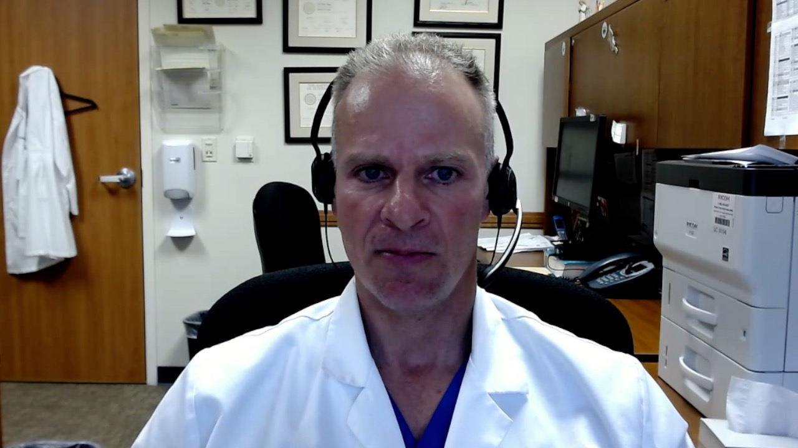
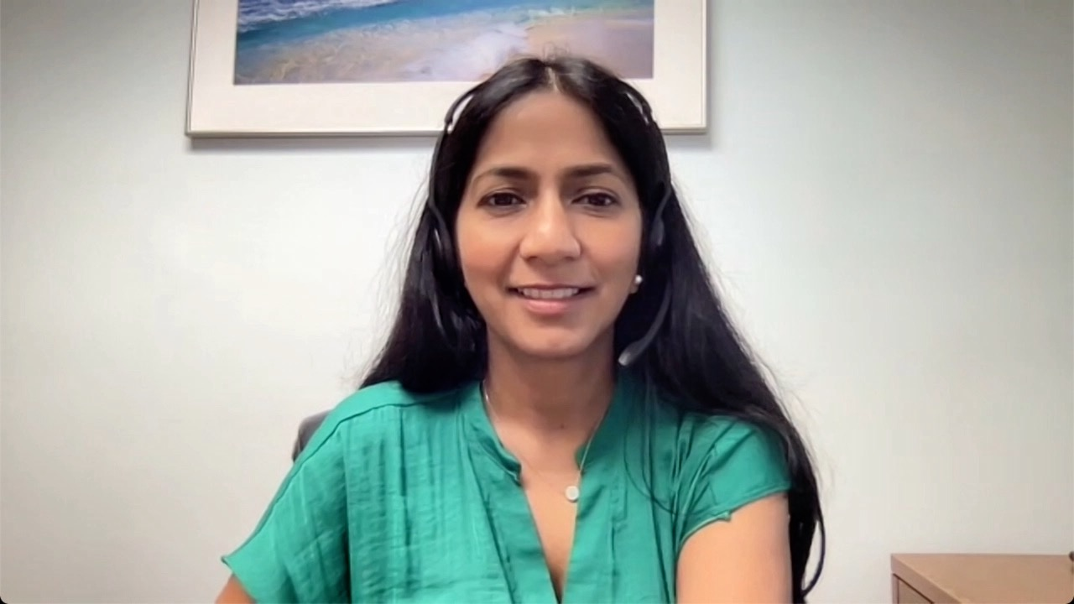
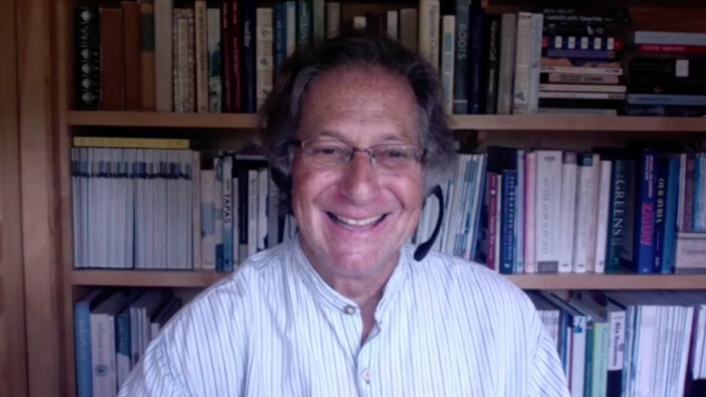

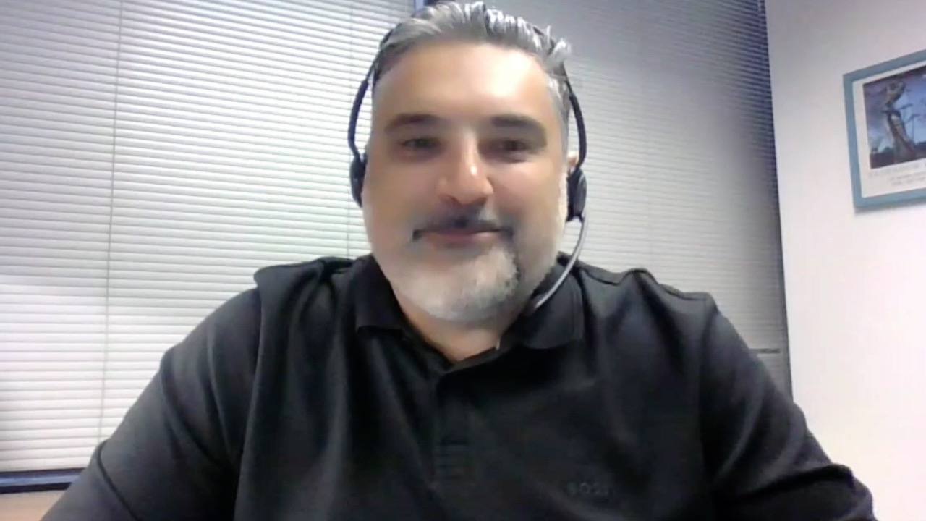
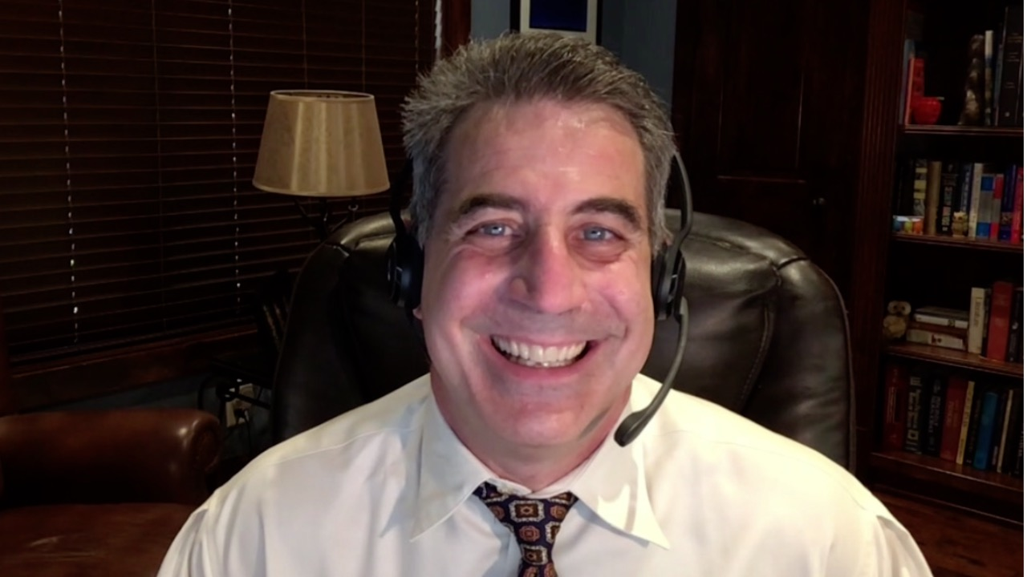
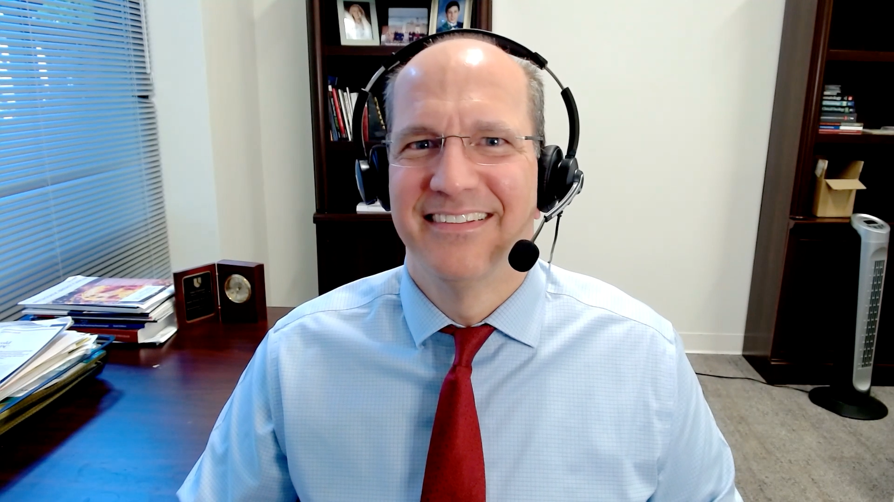

Contributing Medical Oncologists
Warren S Brenner, MD
Lynn Cancer Institute
Boca Raton, Florida
Shaachi Gupta, MD, MPH Florida Cancer Specialists
Lake Worth, Florida
Philip L Brooks, MD
Northern Light Eastern Maine Medical Center and Lafayette Family Cancer Institute
Brewer, Maine
Kimberly Ku, MD
Illinois Cancer Care
Bloomington, Illinois
Farshid Dayyani, MD, PhD
Stern Center for Cancer Clinical Trials and Research
Orange, California
Joseph Martins, MD
UT Health Science Center
Tyler, Texas
Justin Peter Favaro, MD, PhD Oncology Specialists of Charlotte
Charlotte, North Carolina
Neil Morganstein, MD
Atlantic Health System
Summit, New Jersey

Slide 39
Agenda
Introduction: Is Biliary Tract Cancer (BTC) the New Non-Small Cell Lung Cancer? … Why?
Case 1: Do BTC Subtypes Respond Differently to Checkpoint Inhibitors?
Case 2: Anti-HER2-Directed Therapy for HER2-Low BTC?
Case 3: FGFR Inhibitors in the Front-Line Setting?
Case 4: Bone and Muscle Pain with an FGFR Inhibitor
Case 5: Improved Targeted Clinical Benefit for Specific FGFR Mutations?
Case 6: Sequencing of Available HER2-Targeted Agents
Case 7: IDH Inhibitors in Combination with Chemotherapy as Initial Therapy?
Case 8: BRAF and IDH Mutations — Which Targeted Treatment First?
Case 9: Measurable Residual Disease (MRD) as a Biomarker?

Slide 40
Agenda
Introduction: Is Biliary Tract Cancer (BTC) the New Non-Small Cell Lung Cancer? … Why?
Case 1: Do BTC Subtypes Respond Differently to Checkpoint Inhibitors?
Case 2: Anti-HER2-Directed Therapy for HER2-Low BTC?
Case 3: FGFR Inhibitors in the Front-Line Setting?
Case 4: Bone and Muscle Pain with an FGFR Inhibitor
Case 5: Improved Targeted Clinical Benefit for Specific FGFR Mutations?
Case 6: Sequencing of Available HER2-Targeted Agents
Case 7: IDH Inhibitors in Combination with Chemotherapy as Initial Therapy?
Case 8: BRAF and IDH Mutations — Which Targeted Treatment First?
Case 9: Measurable Residual Disease (MRD) as a Biomarker?

Slide 41
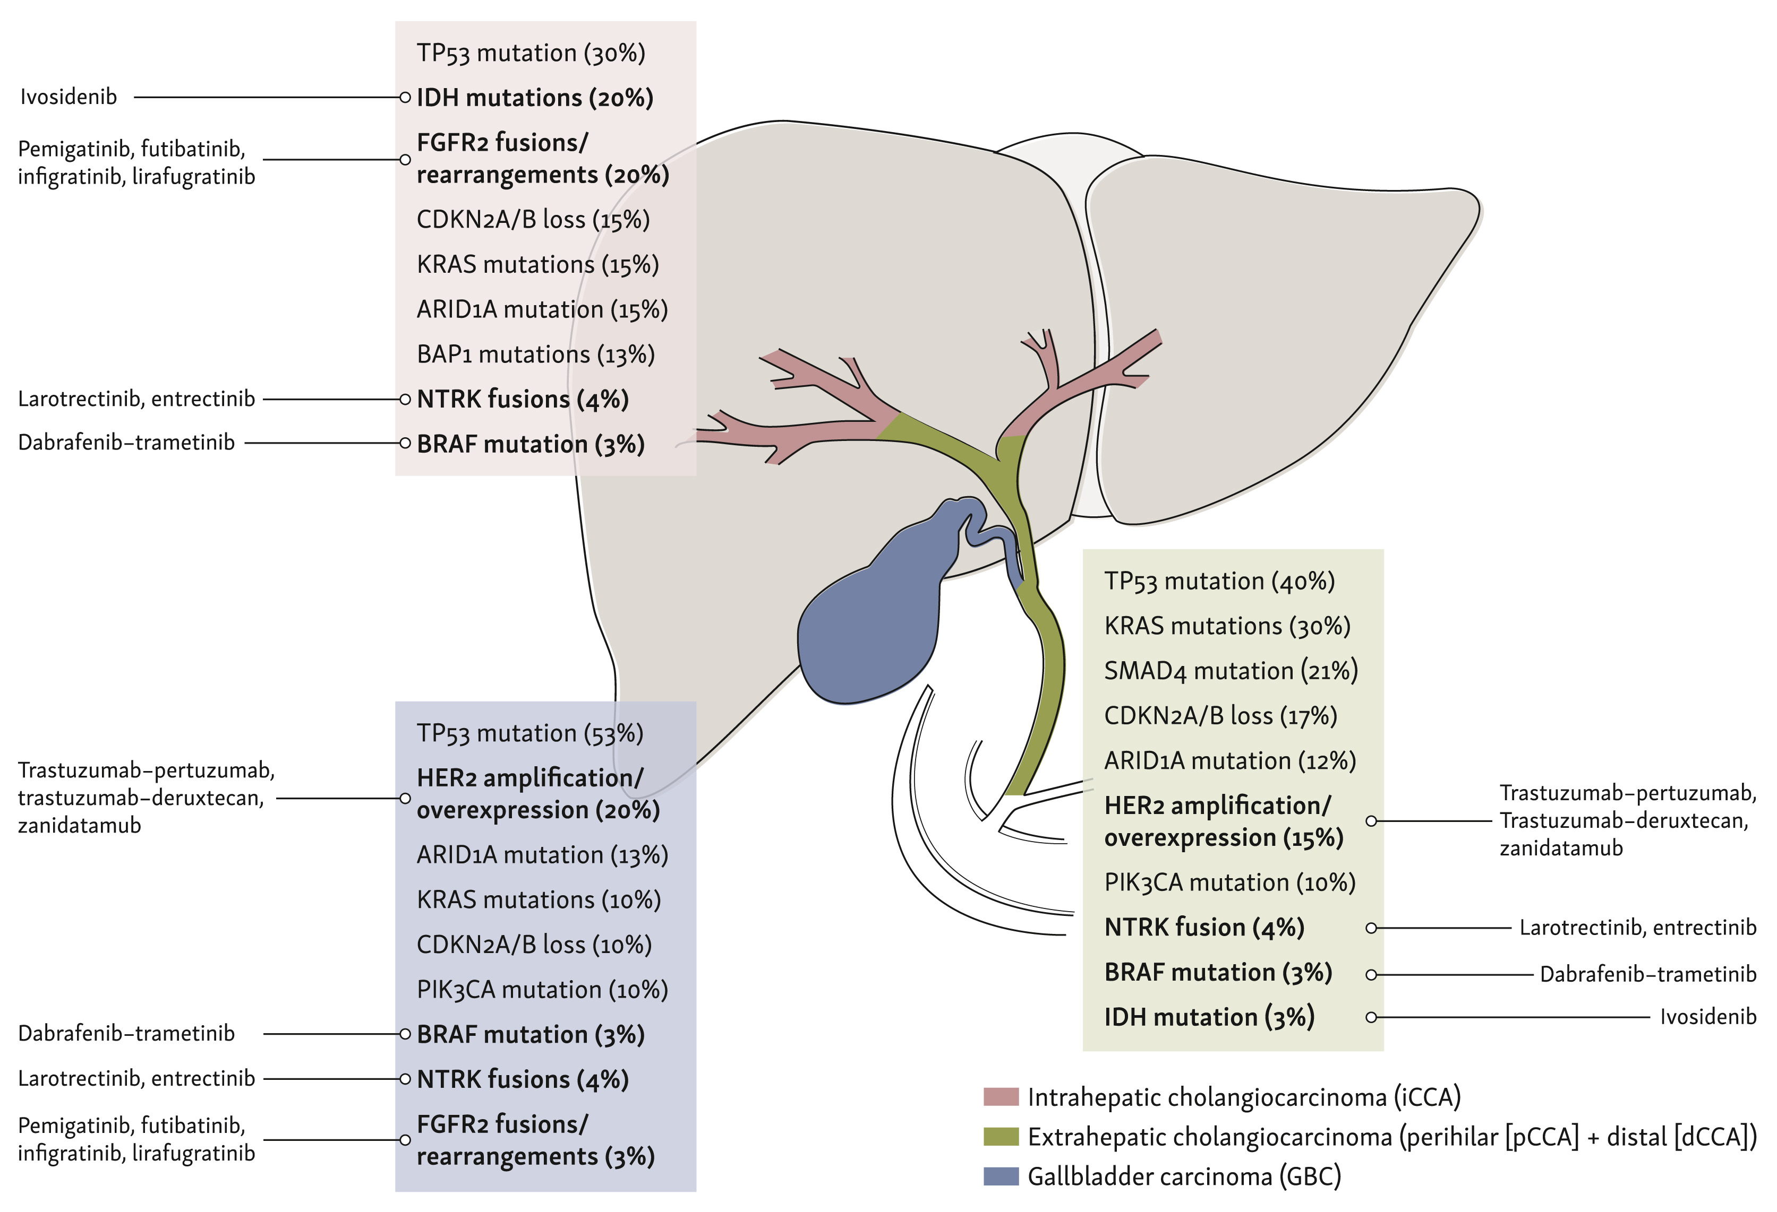
BTC harbor targetable genomic alterations
Courtesy of Haley Ellis, MD
Kehmann et al. ESMO Open 2024C

Slide 42
Agenda
Introduction: Is Biliary Tract Cancer (BTC) the New Non-Small Cell Lung Cancer? … Why?
Case 1: Do BTC Subtypes Respond Differently to Checkpoint Inhibitors?
Case 2: Anti-HER2-Directed Therapy for HER2-Low BTC?
Case 3: FGFR Inhibitors in the Front-Line Setting?
Case 4: Bone and Muscle Pain with an FGFR Inhibitor
Case 5: Improved Targeted Clinical Benefit for Specific FGFR Mutations?
Case 6: Sequencing of Available HER2-Targeted Agents
Case 7: IDH Inhibitors in Combination with Chemotherapy as Initial Therapy?
Case 8: BRAF and IDH Mutations — Which Targeted Treatment First?
Case 9: Measurable Residual Disease (MRD) as a Biomarker?

Slide 43
Case Presentation: 75-year-old woman with metastatic cholangiocarcinoma who received first-line gemcitabine/cisplatin with durvalumab
Dr Warren Brenner (Boca Raton, Florida)

Slide 44
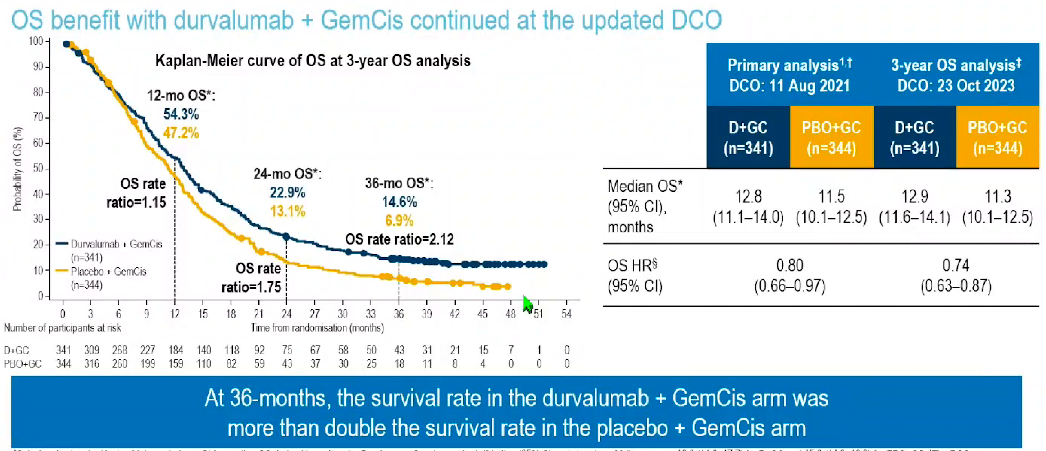
TOPAZ-1 Trial: 3-Year Overall Survival (OS) Update
GemCis = gemcitabine/cisplatin; DCO = data cutoff
Oh D-Y et al. ESMO GI 2024;Abstract 279MO.

Slide 45
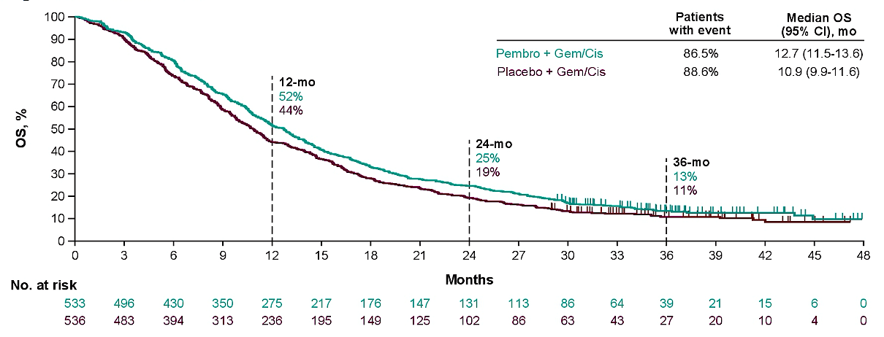
KEYNOTE-966 Trial: 3-Year OS Update
Finn R et al. ASCO 2024;Abstract 4093.

Slide 46
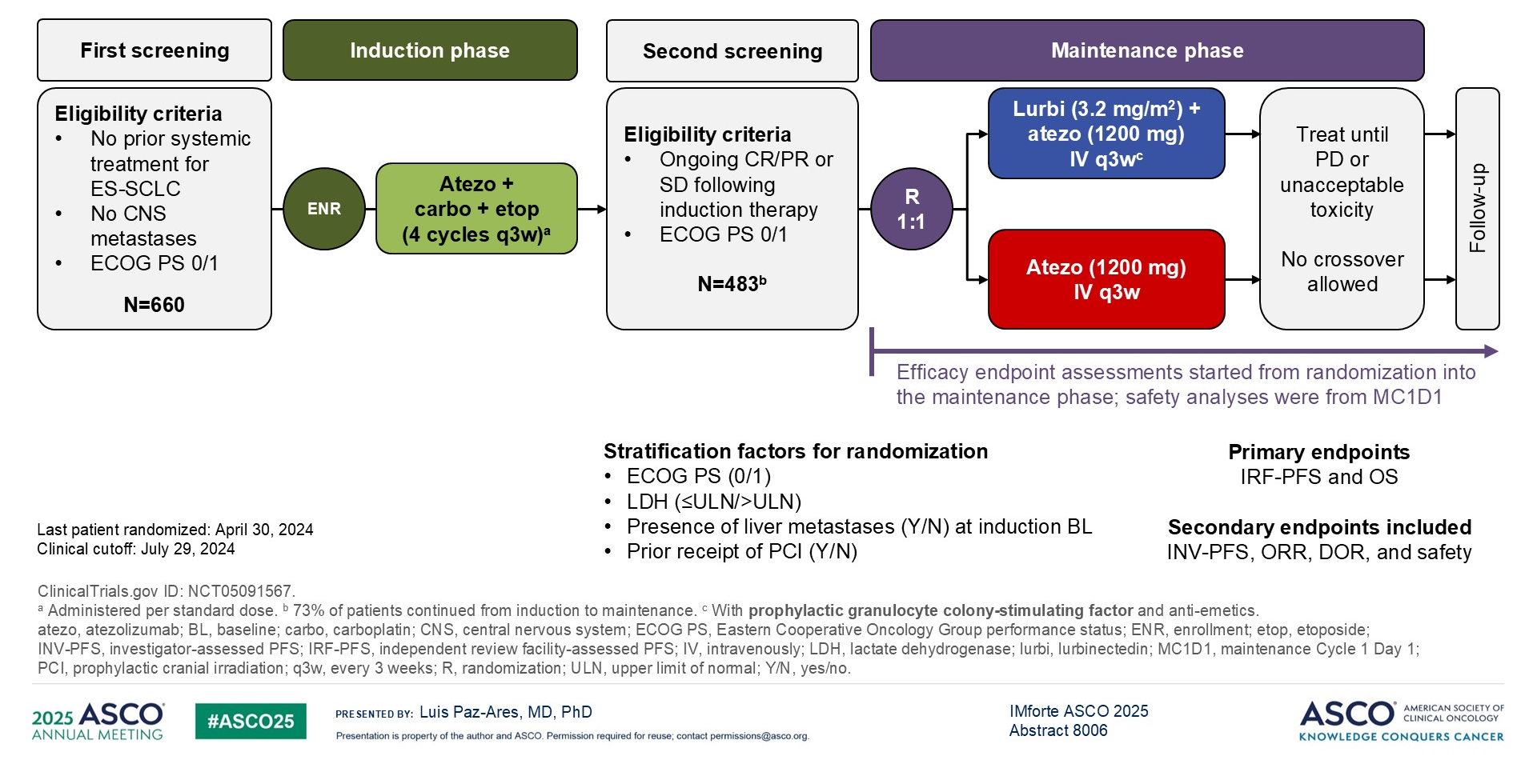
IMforte Study Design
CR = complete response; PR = partial response; SD = stable disease; PD = disease progression
Paz-Ares L et al. ASCO 2025;Abstract 8006. Paz-Ares L et al. Lancet 2025;405(10495):2129-43.

Slide 47
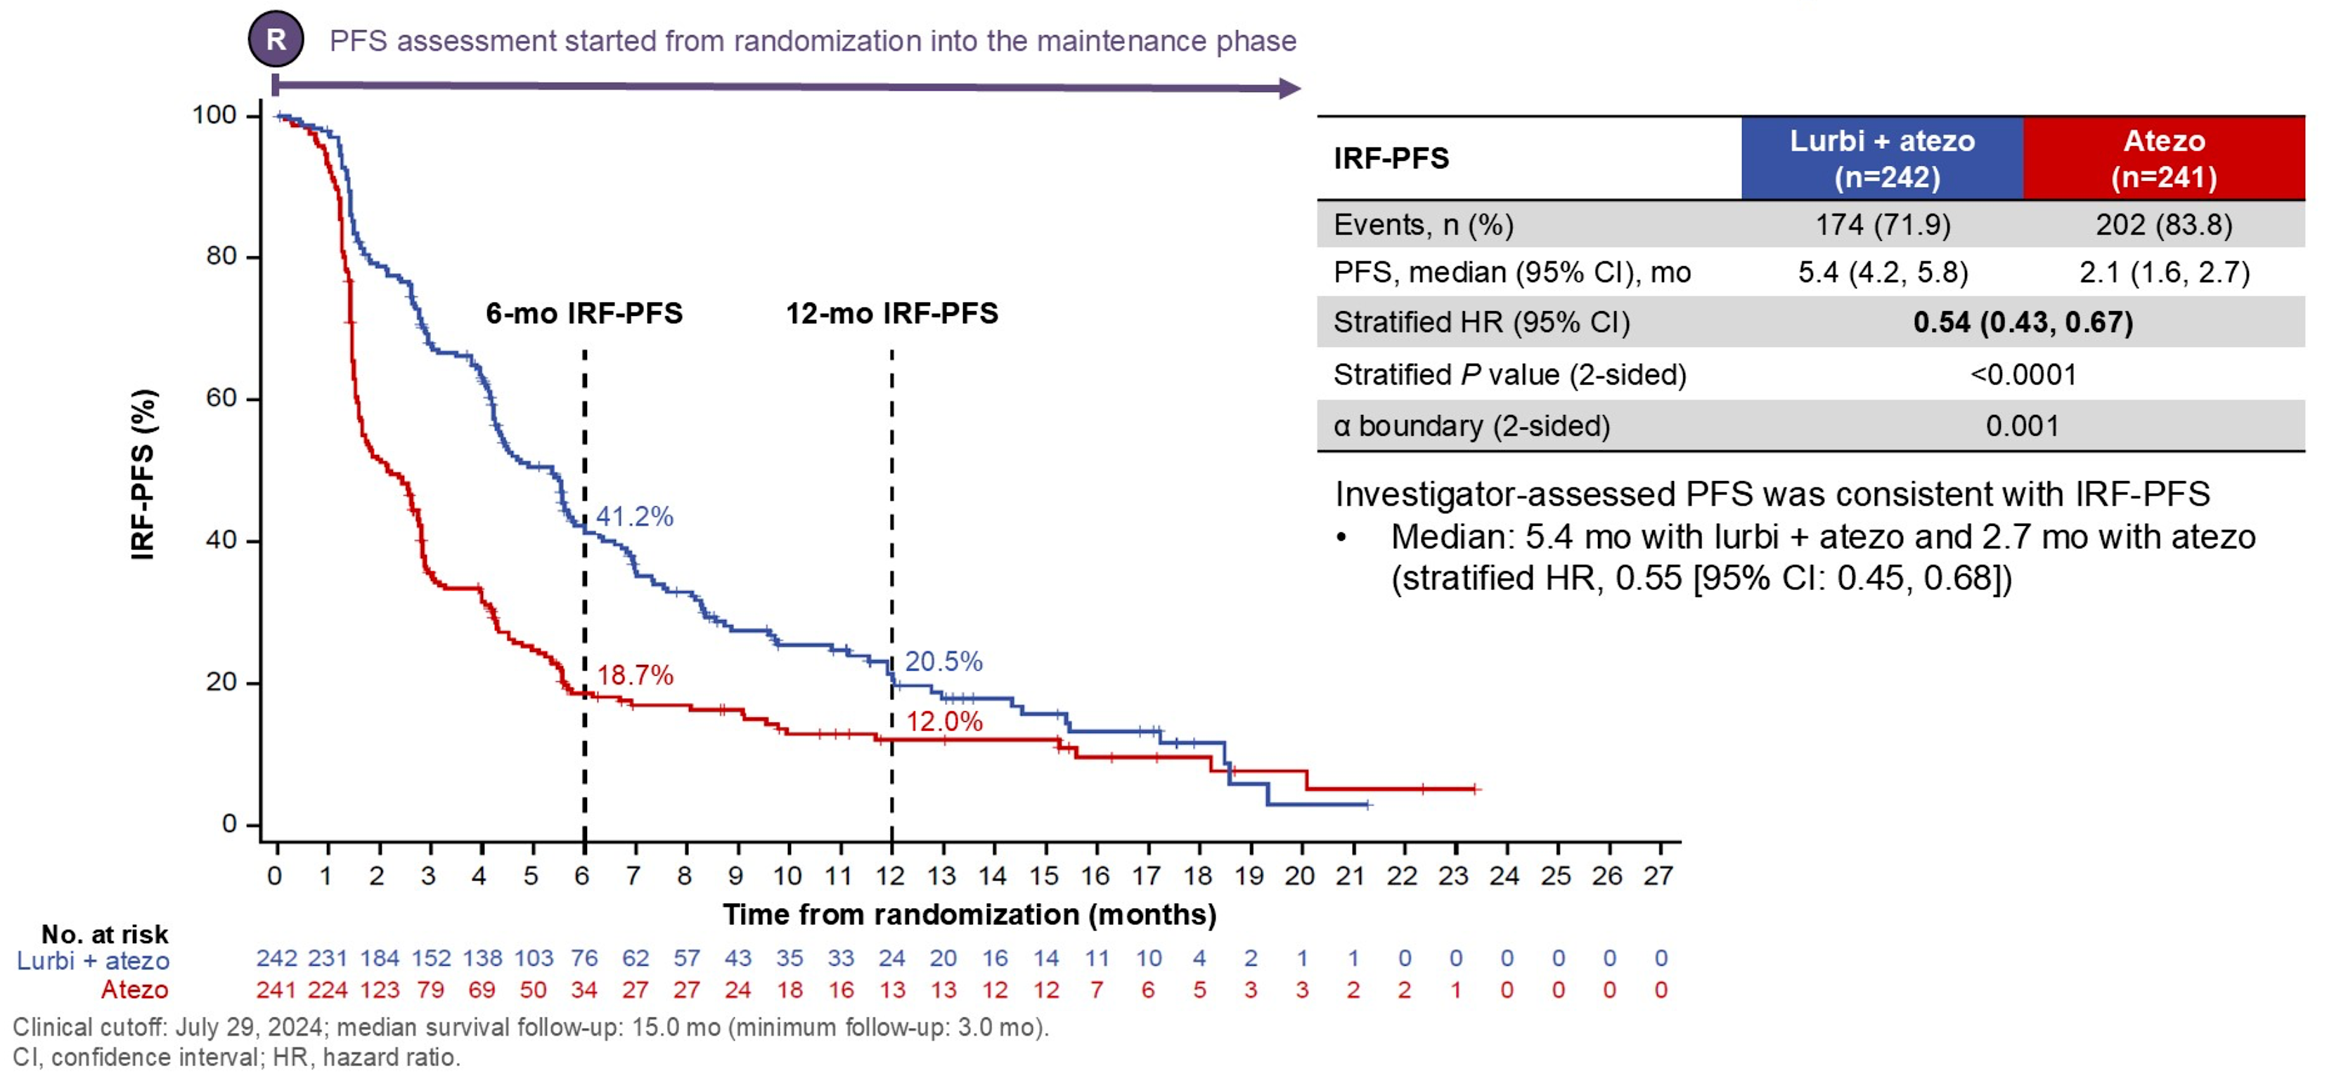
IMforte: PFS from Randomization into Maintenance Phase
Paz-Ares L et al. ASCO 2025;Abstract 8006. Paz-Ares L et al. Lancet 2025;405(10495):2129-43.

Slide 48
NEODISCO Trial: Neoadjuvant Gemcitabine and Cisplatin in Combination with Perioperative Pembrolizumab versus Up-Front Surgery for Patients with Primary Resectable and Borderline-Resectable Perihilar and Distal Cholangiocarcinoma
Key Eligibility Criteria
Age ≥18 years
ECOG PS 0-1
Confirmed resectable or borderline resectable pCCA and dCCA
No prior therapy with anti-PD-1 or anti-PD-L1 antibodies or other agents directed to another stimulatory or co-inhibitory T-cell receptor
Neoadjuvant gemcitabine + cisplatin + perioperative pembrolizumab (IV)
Non-randomized
R
N = 150
Surgery
Primary Outcome Measure: Event-free survival
pCCA = perihilar cholangiocarcinoma; dCCA = distal cholangiocarcinoma; IV = intravenous
www.clinicaltrials.gov. NCT06923475. Accessed August 2025.

Slide 49
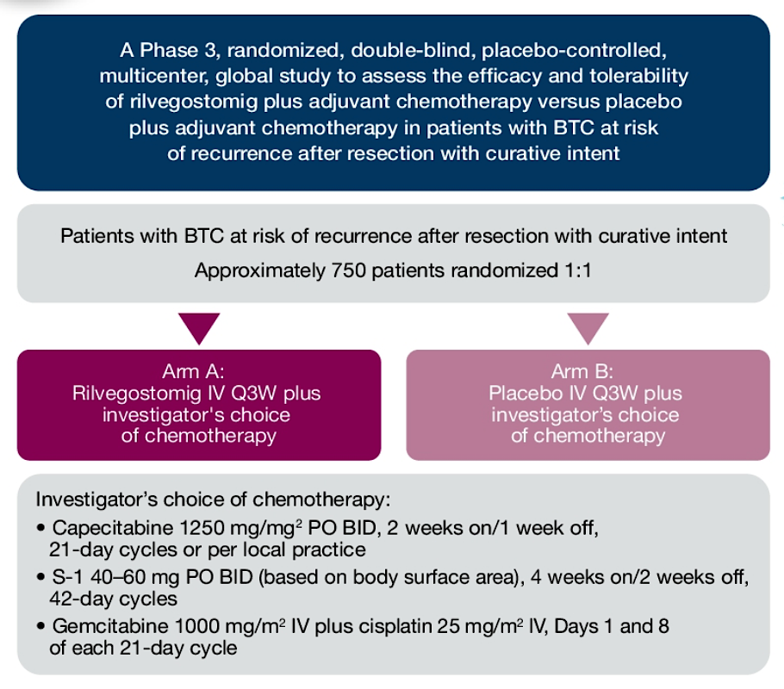
ARTEMIDE-Biliary01 Trial: Rilvegostomig and Chemotherapy as Adjuvant Therapy for Biliary Tract Cancer After Resection
Fan J et al. ASCO 2024;Abstract TPS4199.

Slide 50
Agenda
Introduction: Is Biliary Tract Cancer (BTC) the New Non-Small Cell Lung Cancer? … Why?
Case 1: Do BTC Subtypes Respond Differently to Checkpoint Inhibitors?
Case 2: Anti-HER2-Directed Therapy for HER2-Low BTC?
Case 3: FGFR Inhibitors in the Front-Line Setting?
Case 4: Bone and Muscle Pain with an FGFR Inhibitor
Case 5: Improved Targeted Clinical Benefit for Specific FGFR Mutations?
Case 6: Sequencing of Available HER2-Targeted Agents
Case 7: IDH Inhibitors in Combination with Chemotherapy as Initial Therapy?
Case 8: BRAF and IDH Mutations — Which Targeted Treatment First?
Case 9: Measurable Residual Disease (MRD) as a Biomarker?

Slide 51
Case Presentation: 79-year-old man with history of Crohn’s disease and metastatic biliary cancer (HER2 IHC 2+) discontinues first-line chemotherapy/IO due to exacerbation of Crohn’s
Dr Neil Morganstein (Summit, New Jersey)

Slide 52
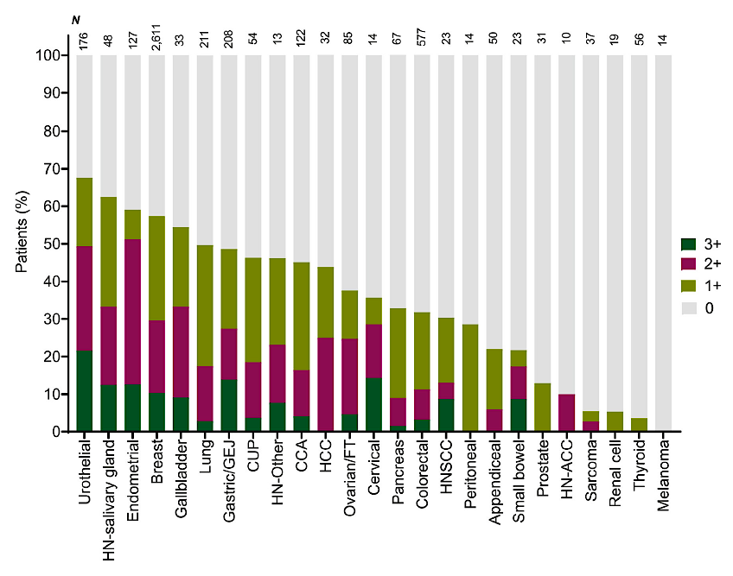
Distribution of HER2 IHC Expression Levels Across Cancer Types
Uzunparmak B et al. Ann Oncol 2023 November;34(11):1035-46.
.
.

Slide 53
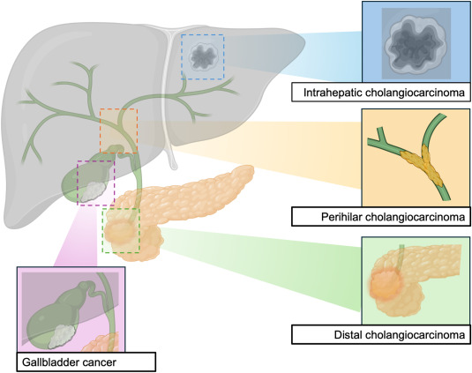

HER2 amplification/overexpression spans all BTC subtypes
Intrahepatic cholangiocarcinoma
(iCCA)
~3-5%
Extrahepatic cholangiocarcinoma
(eCCA)
~10-20%
Gallbladder cancer
(GBC)
~15-35%
HER2 positivity is associated with a worse prognosis in advanced BTC
Courtesy of Haley Ellis, MD
Galdy et al. Cancer Metastasis Rev 2017 | Ayasun et al. Cancers 2023 | Lee et al. ASCO GI 2025 | Soreide et al. Eur J Surg Oncol 2025

Slide 54
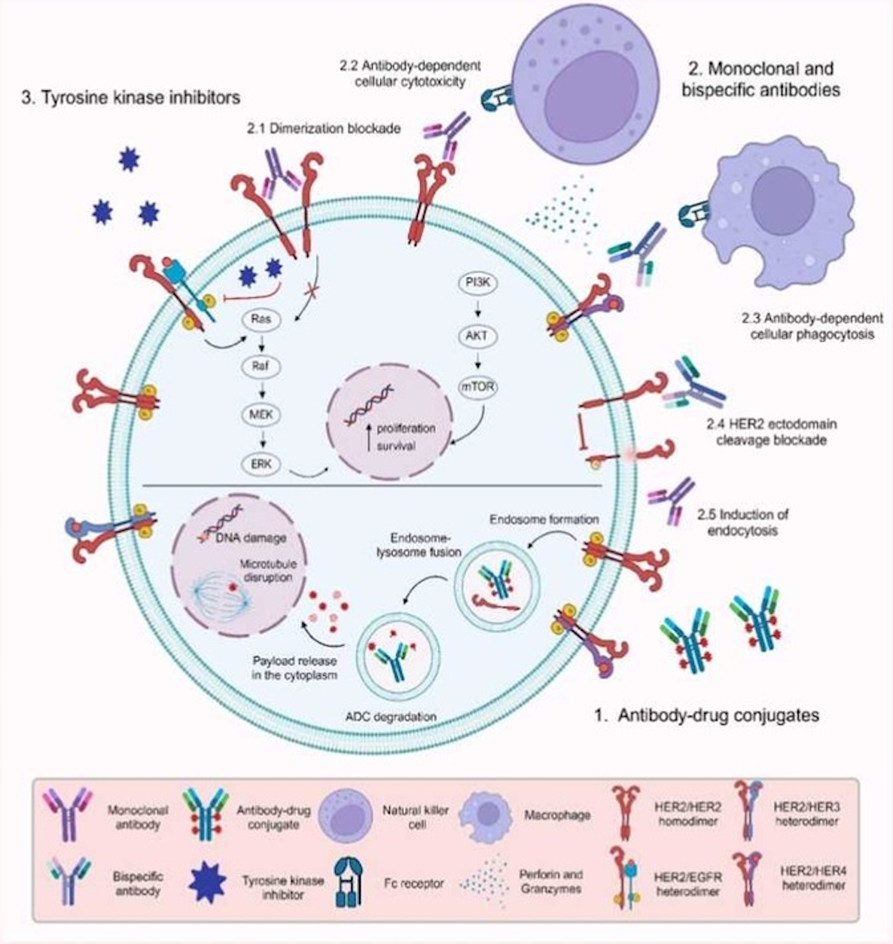
HER2-Targeted Modalities in Biliary Tract Cancers
Theocharopoulos C et al. Crit Rev Oncol Hematol 2025 April;208:104655.

Slide 55



HER2 testing in BTC: who, when, and how
✅ WHO: All patients with locally advanced or metastatic BTC (GBC, eCCA, iCCA)
✅ WHEN: At diagnosis
    1st line trials!
    Future direction: consider earlier testing for neoadjuvant/perioperative strategies
✅ HOW:
Immunohistochemistry (IHC) 🔬
In situ hybridization (ISH) 🧬
Next-generation sequencing (NGS) 🎯
What it detects
HER2 protein
ERBB2 DNA
ERBB2 DNA
What it indicates
HER2 overexpression
ERBB2 amplification
ERBB2 amplification
Tissue and/or blood-based
Courtesy of Haley Ellis, MD
Javle et al. Cancer 2016 | Jacobi et al. Oncol Res Treat 2021

Slide 56
HER2 testing in BTC follows gastroesophageal cancer guidelines
Patients with locally advanced or metastatic BTC
HER2 testing using IHC 🔬
Score 0 or 1+
Score 2+
Score 3+
HER2 negative
Inconclusive
HER2 positive
No further testing required
No further testing required
HER2 testing using ISH 🧬
Gene not amplified
Gene amplified
HER2 negative
HER2 positive
Courtesy of Haley Ellis, MD
Roche Diagnostics

Slide 57
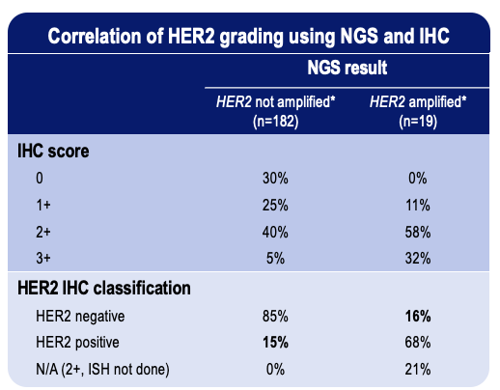
Comprehensive HER2 testing with NGS and IHC is important
~15% discordance between HER2 assessment by NGS vs IHC in BTC
Courtesy of Haley Ellis, MD
Lee et al. ASCO GI 2025
Notes:
HER2-positive (IHC 3+ or 2+/ISH+) or NGS (amp)
N=389 pts in Korea and US
201 pts with NGS data → 93% HER2 non-amplified → of these, 15% were HER2+ by IHC

Slide 58
Evolving treatment landscape in HER2+ BTC
in second-line setting and beyond
 | Treatment | Trial | # BTC pts | Prior HER2 Tx | HER2 Status | ORR | DCR | mDOR (mo) | mPFS (mo) | mOS (mo)
ABC-06¹ 2021 | FOLFOX | Phase 3 | 162 | -- | -- | 5% | 33% | -- | 4.0 | 6.2
MyPathway² 2021 | Trastuzumab + Pertuzumab | Phase 2a | 39 | No | IHC 3+, ISH+, or NGS Amp | 23% | 51% | 10.8 | 4.0 | 10.9
KCSG-HB19-14³ 2023 | Trastuzumab + FOLFOX | Phase 2 | 34 | No | IHC 3+, IHC 2+/ISH+, or NGS Amp | 29% | 79% | 4.9 | 5.1 | 10.7
HERIZON-BTC-01⁴ 2023 | Zanidatamab | Phase 2b | 62 80 | No | IHC 3+ IHC 3+ or IHC 2+/Amp | 52% 41% | 79% 69% | 14.9 12.9 | 7.2 5.5 | 18.1 15.5
SGNTUC-019⁵ 2023 | Trastuzumab + Tucatinib | Phase 2 | 30 | No | IHC 3+, ISH+, or NGS Amp | 47% | 77% | 6.0 | 5.5 | 15.5
DESTINY-PanTumor02⁶ 2023 | Trastuzumab Deruxtecan | Phase 2 | 16 41 14 | Yes (17%) | IHC 3+ IHC 3+ or 2+ IHC 2+ | 56% 22% 0% | 78% -- -- | 22.1 8.6 -- | 7.4 4.6 4.2 | 12.4 7.0 6.0
HERB⁷ 2024 | Trastuzumab Deruxtecan | Phase 2 | 22 8 | Yes (n=0) | IHC 3+ or IHC 2+/ISH+ IHC 2+/ISH-, IHC 1+, or IHC 0/ISH+ | 36% 13% | 82% 75% | 7.4 -- | 5.1 3.5 | 7.1 8.9
¹Lamarca et al. Lancet Oncol 2021 | ²Javle et al. Lancet Oncol 2021 | ³Lee et al. Lancet Gastroenterol Hepatol 2023 | ⁴Harding, Fan, et al. Lancet Oncol 2023 | ⁵Nakamura et al. J Clin Oncol 2023 | ⁶Meric-Bernstam et al. J Clin Oncol 2023 | ⁷Ohba et al. J Clin Oncol 2024
Courtesy of Haley Ellis, MD

Slide 59
Agenda
Introduction: Is Biliary Tract Cancer (BTC) the New Non-Small Cell Lung Cancer? … Why?
Case 1: Do BTC Subtypes Respond Differently to Checkpoint Inhibitors?
Case 2: Anti-HER2-Directed Therapy for HER2-Low BTC?
Case 3: FGFR Inhibitors in the Front-Line Setting?
Case 4: Bone and Muscle Pain with an FGFR Inhibitor
Case 5: Improved Targeted Clinical Benefit for Specific FGFR Mutations?
Case 6: Sequencing of Available HER2-Targeted Agents
Case 7: IDH Inhibitors in Combination with Chemotherapy as Initial Therapy?
Case 8: BRAF and IDH Mutations — Which Targeted Treatment First?
Case 9: Measurable Residual Disease (MRD) as a Biomarker?

Slide 60
Case Presentation: 72-year-old man with metastatic cholangiocarcinoma (FGFR2 rearrangement) receives gemcitabine/oxaliplatin with durvalumab and experiences a rapid clinical decline
Dr Kimberly Ku (Bloomington, Illinois)

Slide 61
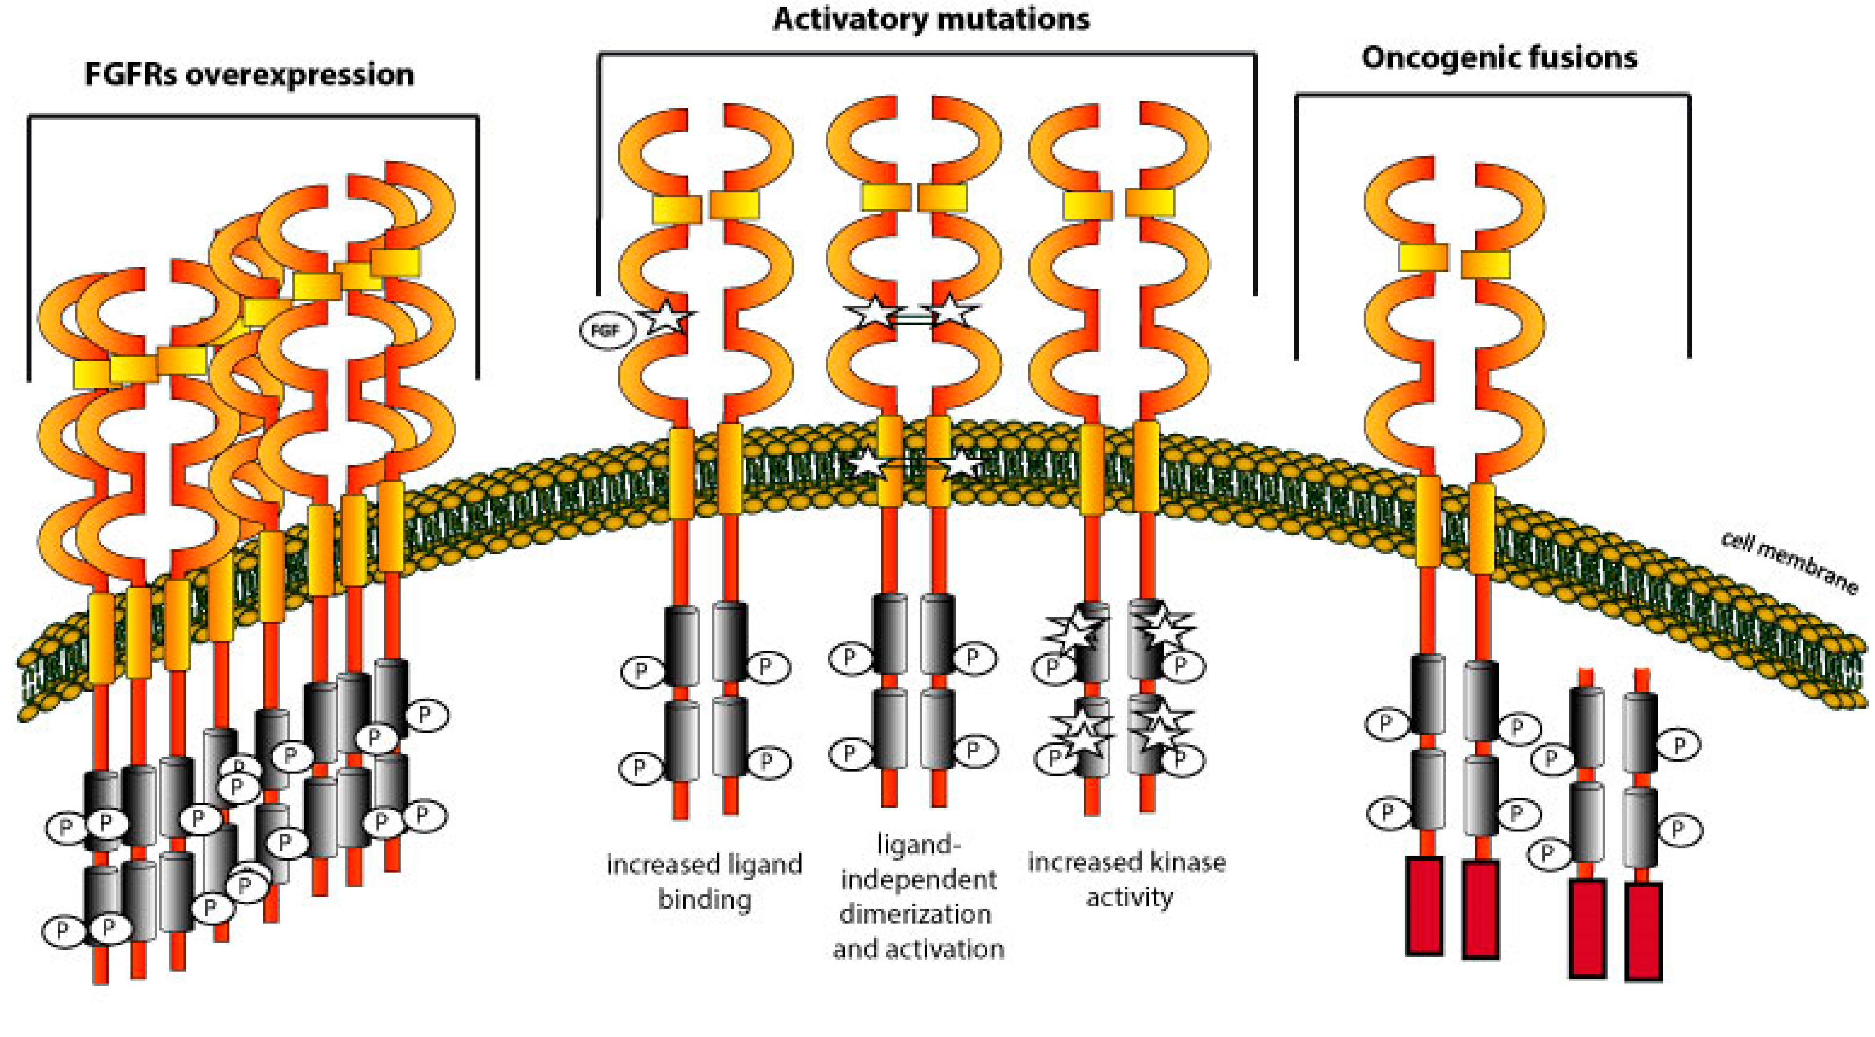
Cellular Trafficking of FGFR as a Therapeutic Target for Intrahepatic Cholangiocarcinoma
Porębska N et al. J Clin Med 2019 December 20;8(1):7.

Slide 62
Efficacy of FDA-Approved FGFR Inhibitors for Cholangiocarcinoma with an FGFR2 Fusion
 | Pemigatinib (N = 108) | Futibatinib (N = 67)
Objective response rate | 37.0% | 42.0%
Disease control rate | 82.4% | 83.0%
Median progression-free survival | 7.0 mo | 9.0 mo
Median overall survival | 17.5 mo | 21.7 mo
Toxicities | Hyperphosphatemia, alopecia, diarrhea | Hyperphosphatemia, diarrhea, dry mouth
Vogel A et al. ESMO Open 2024;9(6):103488; Goyal L et al. N Engl J Med 2023;388:228-39.

Slide 63
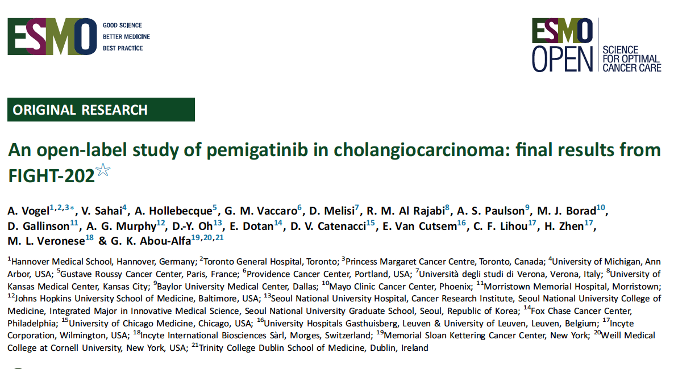
2024;9(6):103488.

Slide 64
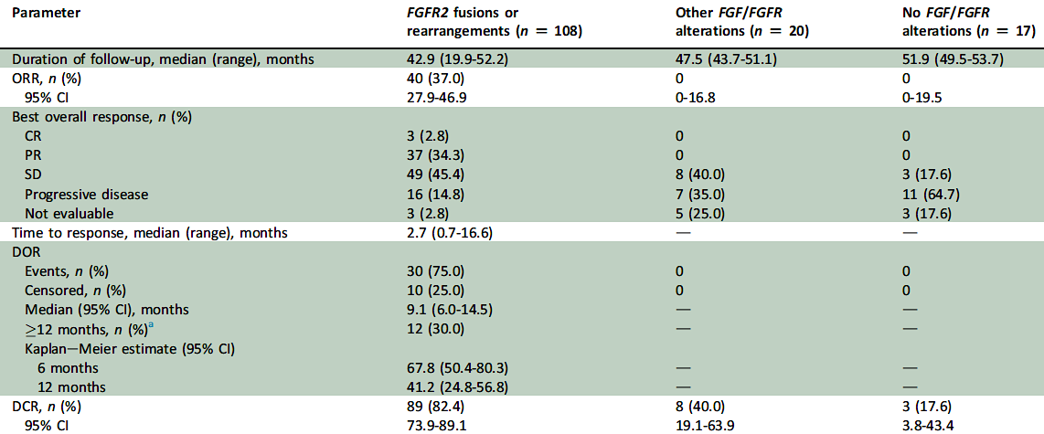
FIGHT-202 Final Results: Response to Pemigatinib
ORR = objective response rate
Vogel A et al. ESMO Open 2024;9(6):103488.

Slide 65
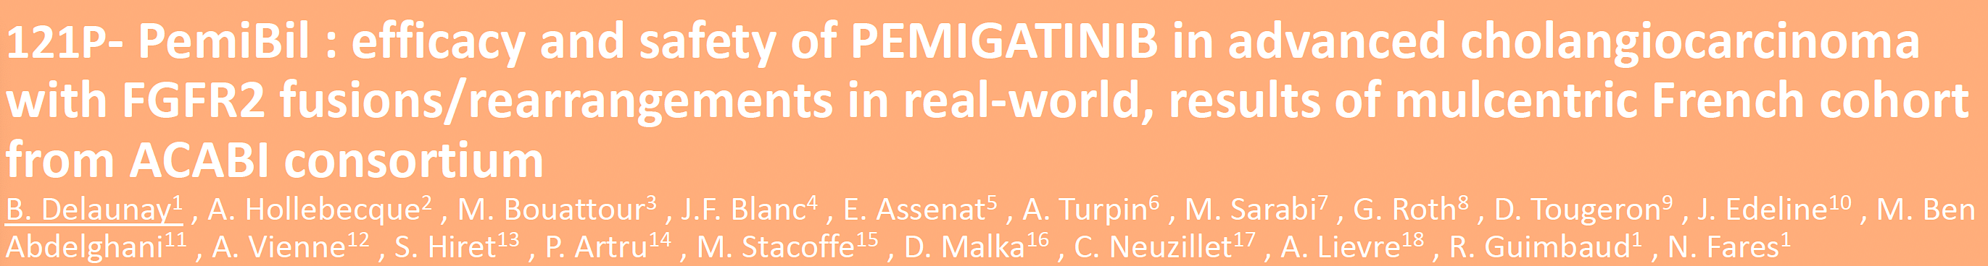
multicentric French cohort
Delaunay B et al. ESMO 2023;Abstract 121P.

Slide 66
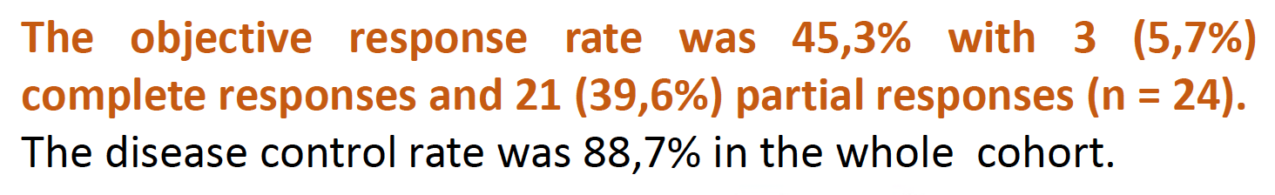
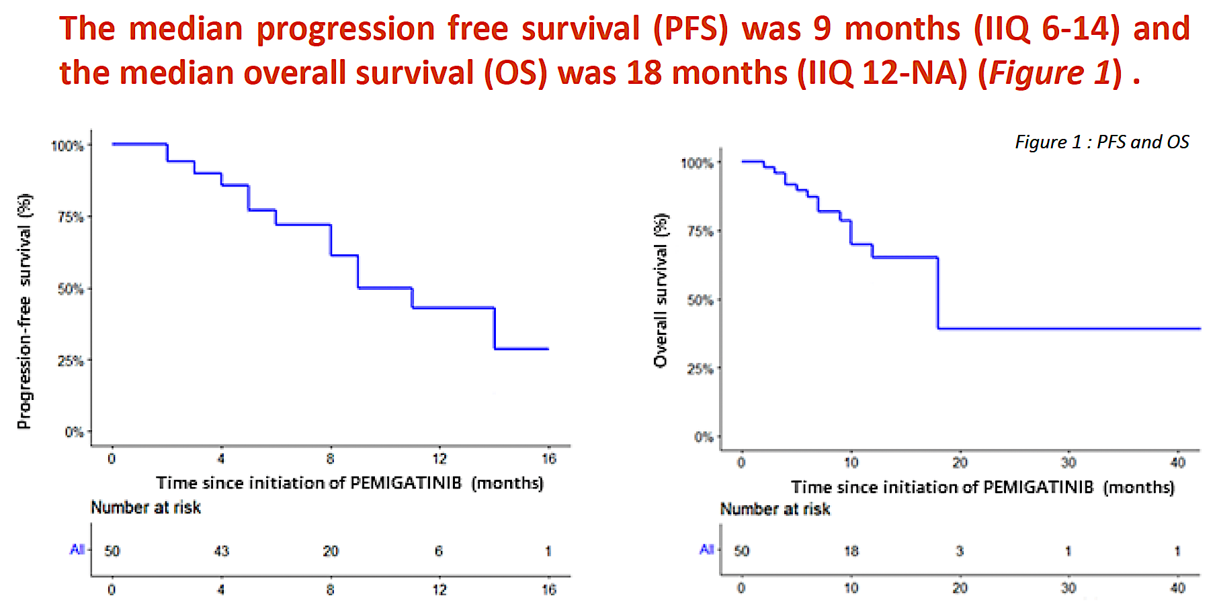
Real-World Efficacy with Pemigatinib
Delaunay B et al. ESMO 2023;Abstract 121P.

Slide 67
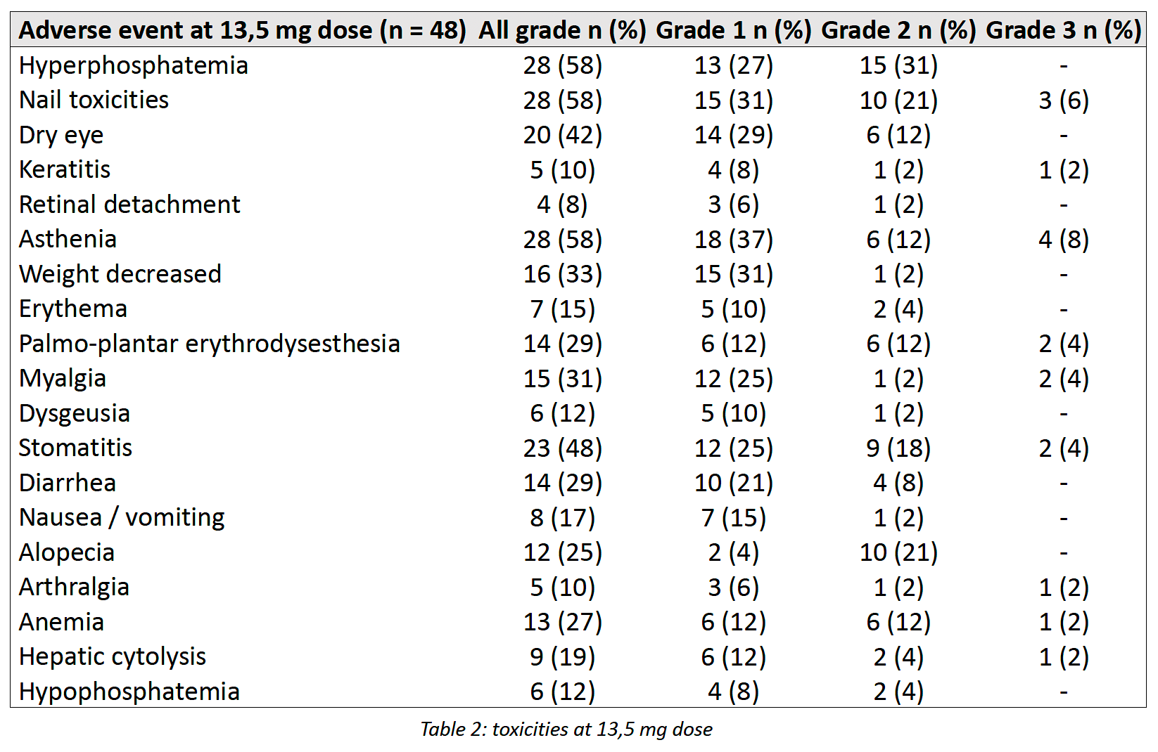
Real-World Safety with Pemigatinib
Delaunay B et al. ESMO 2023;Abstract 121P.

Slide 68
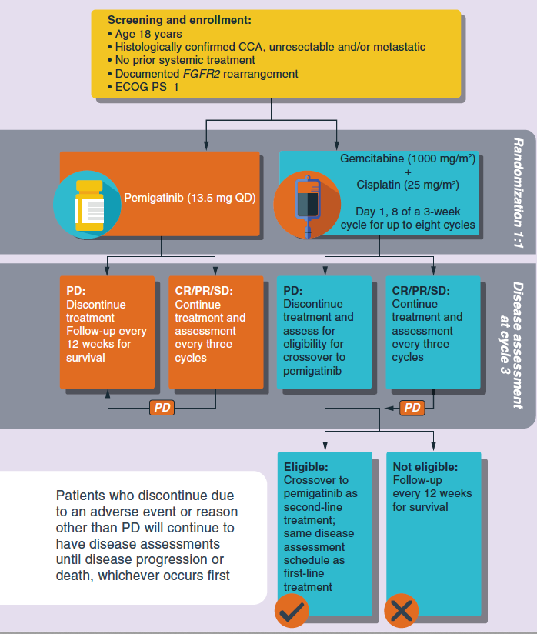
FIGHT-302: An Ongoing Phase III Trial of First-Line Pemigatinib versus Gemcitabine/Cisplatin for Advanced Cholangiocarcinoma with FGFR2 Rearrangements
Trial identifier: NCT03656536 (Closed)
Actual enrollment: 167
Primary endpoint: Progression-free survival
CCA = cholangiocarcinoma; PD = disease progression
Bekaii-Saab T et al. Future Oncol 2020;16(30):2385-99;
www.clinicaltrials.gov. Accessed August 2025.

Slide 69
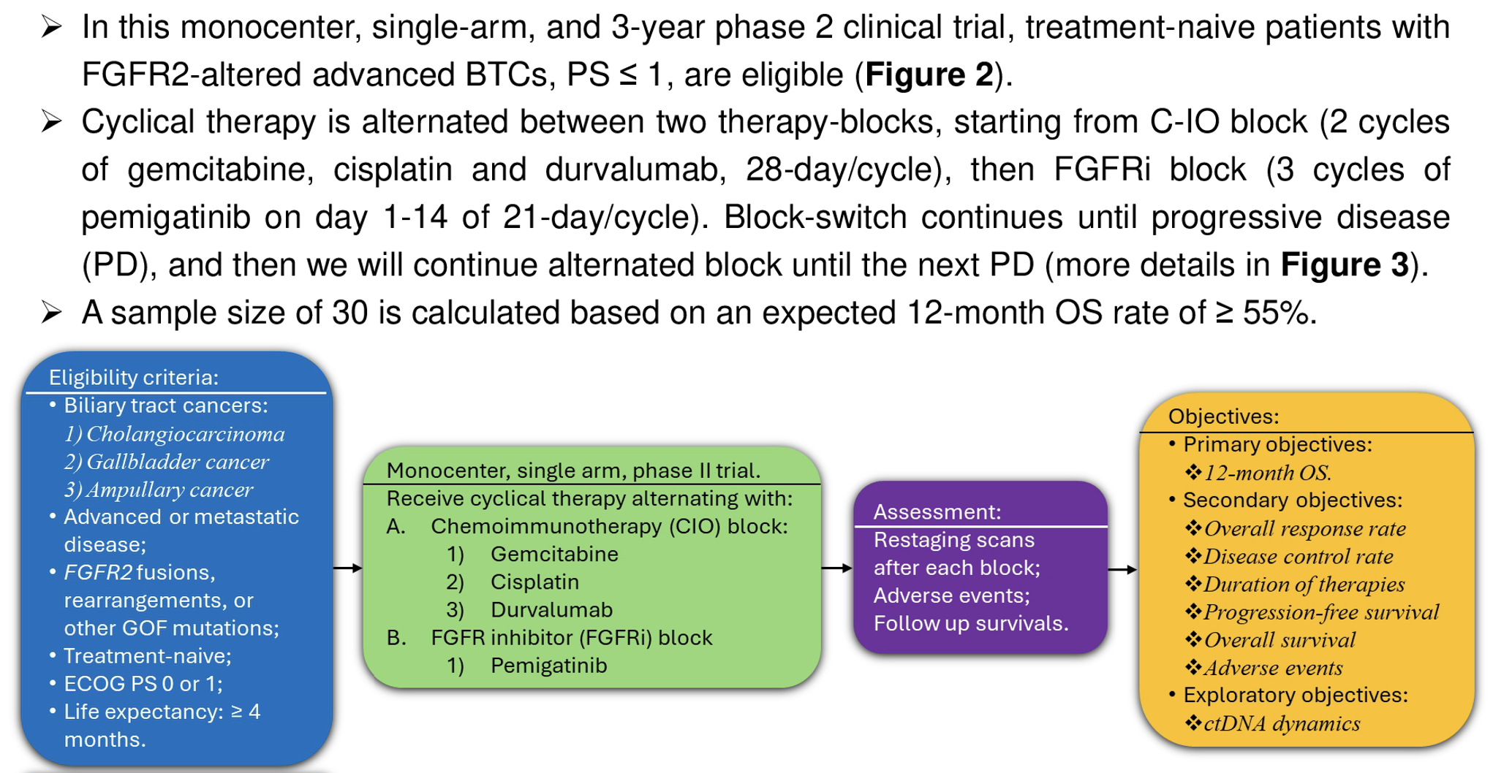
Phase IIa Study of First-Line Cyclical Therapy Alternating
Durvalumab/Gemcitabine/Cisplatin with Pemigatinib
Li C et al. Gastrointestinal Cancers Symposium 2025;Abstract TPS645.

Slide 70
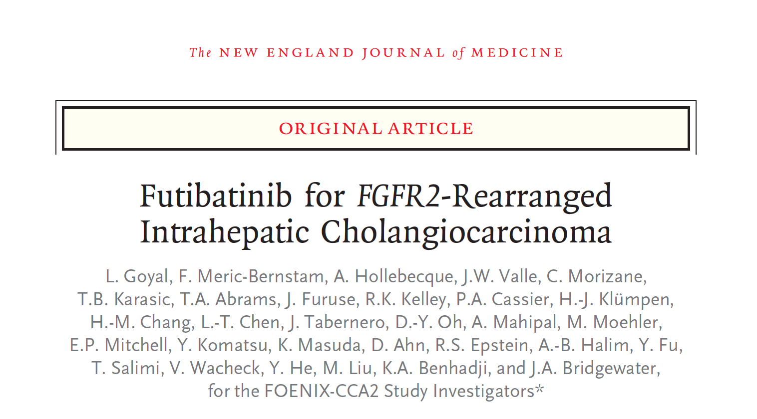
2023;388:228-39.

Slide 71
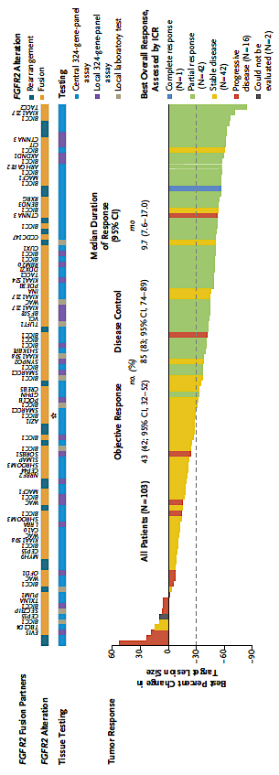
FOENIX-CCA2: A Phase II Study of Futibatinib for Intrahepatic Cholangiocarcinoma with FGFR2 Fusions or Rearrangements
Median PFS: 9.0 mo
Median OS: 21.7 mo
Goyal L et al. N Engl J Med 2023;388:228-39.

Slide 72
Agenda
Introduction: Is Biliary Tract Cancer (BTC) the New Non-Small Cell Lung Cancer? … Why?
Case 1: Do BTC Subtypes Respond Differently to Checkpoint Inhibitors?
Case 2: Anti-HER2-Directed Therapy for HER2-Low BTC?
Case 3: FGFR Inhibitors in the Front-Line Setting?
Case 4: Bone and Muscle Pain with an FGFR Inhibitor
Case 5: Improved Targeted Clinical Benefit for Specific FGFR Mutations?
Case 6: Sequencing of Available HER2-Targeted Agents
Case 7: IDH Inhibitors in Combination with Chemotherapy as Initial Therapy?
Case 8: BRAF and IDH Mutations — Which Targeted Treatment First?
Case 9: Measurable Residual Disease (MRD) as a Biomarker?

Slide 73
Case Presentation: 60-year-old man with metastatic cholangiocarcinoma (FGFR2 rearrangement) experiences severe muscle pain while receiving infigratinib
Dr Joseph Martins (Tyler, Texas)

Slide 74
Agenda
Introduction: Is Biliary Tract Cancer (BTC) the New Non-Small Cell Lung Cancer? … Why?
Case 1: Do BTC Subtypes Respond Differently to Checkpoint Inhibitors?
Case 2: Anti-HER2-Directed Therapy for HER2-Low BTC?
Case 3: FGFR Inhibitors in the Front-Line Setting?
Case 4: Bone and Muscle Pain with an FGFR Inhibitor
Case 5: Improved Targeted Clinical Benefit for Specific FGFR Mutations?
Case 6: Sequencing of Available HER2-Targeted Agents
Case 7: IDH Inhibitors in Combination with Chemotherapy as Initial Therapy?
Case 8: BRAF and IDH Mutations — Which Targeted Treatment First?
Case 9: Measurable Residual Disease (MRD) as a Biomarker?

Slide 75
Case Presentation: 49-year-old woman with Stage IV recurrent cholangiocarcinoma (FGFR2 rearrangement) receives pemigatinib
Dr Justin Favaro (Charlotte, North Carolina)

Slide 76
Phase I/II Trial of Pemigatinib in Combination with Atezolizumab and Bevacizumab for Advanced Cholangiocarcinoma with FGFR2 Fusion
Key Eligibility Criteria
Age ≥18 years
Metastatic or advanced unresectable cholangiocarcinoma
FGFR2 fusion or rearrangement
Refractory, intolerant, received or refused access to first-line gemcitabine-based therapy +/- durvalumab or pembrolizumab
ECOG PS of 0 or 1
Pemigatinib (PO)
Atezolizumab (IV)
Bevacizumab (IV)
Non-randomized
N = 25
Non-randomized
Primary Outcome Measures: Safety and adverse events
PO = By mouth; IV = Intravenous
www.clinicaltrials.gov. NCT06439485. Accessed August 2025.

Slide 77
Phase II Study of Pemigatinib and Durvalumab for Previously Treated Advanced Intrahepatic Cholangiocarcinoma with FGFR2 Fusion or Rearrangement
Key Eligibility Criteria
Age ≥18 years
Locally advanced unresectable or metastatic intrahepatic cholangiocarcinoma with FGFR2 fusion or rearrangement
ECOG PS of 0 or 1
FGFR inhibitor-naïve
Received gemcitabine, cisplatin and durvalumab or another anti-PD-1 Ab with either disease progression, intolerance to cytotoxic chemotherapy or at least 6 months of therapy with stable disease or partial response.
Neo(adjuvant) therapy permitted if no disease recurrence ≤ 6 mo after completion
Pemigatinib 13.5 mg (PO)
Durvalumab 1,500 mg (IV)
Non-randomized
N=38
Non-randomized
Primary Outcome Measure: Confirmed objective response rate
Ab = antibody
www.clinicaltrials.gov. NCT06728410. Accessed August 2025.

Slide 78
Pemigatinib with Afatinib for Advanced Refractory Solid Tumors
Key Eligibility Criteria
Age ≥18 years
Advanced solid tumor where standard curative or palliative measures are no longer effective, appropriate or safe
FGFR1-2 fusion, rearrangement, activating mutation or FGFR2 extracellular domain in-frame deletion
ECOG PS 0-1
Phase Ia Dose Escalation
Afatinib q21d (PO)
Pemigatinib q21d (PO)
Phase Ib Cohort 1 (FGFRi-naïve)
Afatinib q21d (PO)
Pemigatinib q21d (PO)
Non-randomized
N=70
Non-randomized
Phase Ib Cohort 2 (FGFRi-pretreated)
Afatinib q21d (PO)
Pemigatinib q21d (PO)
Primary Outcome Measures: maximum tolerated dose, objective response rate
FGFRi = FGFR inhibitor
www.clinicaltrials.gov. NCT06728410. Accessed August 2025.

Slide 79
Agenda
Introduction: Is Biliary Tract Cancer (BTC) the New Non-Small Cell Lung Cancer? … Why?
Case 1: Do BTC Subtypes Respond Differently to Checkpoint Inhibitors?
Case 2: Anti-HER2-Directed Therapy for HER2-Low BTC?
Case 3: FGFR Inhibitors in the Front-Line Setting?
Case 4: Bone and Muscle Pain with an FGFR Inhibitor
Case 5: Improved Targeted Clinical Benefit for Specific FGFR Mutations?
Case 6: Sequencing of Available HER2-Targeted Agents
Case 7: IDH Inhibitors in Combination with Chemotherapy as Initial Therapy?
Case 8: BRAF and IDH Mutations — Which Targeted Treatment First?
Case 9: Measurable Residual Disease (MRD) as a Biomarker?

Slide 80
Case Presentation: 63-year-old woman with HER2-positive cholangiocarcinoma develops metastatic disease during adjuvant capecitabine therapy
Dr Neil Morganstein (Summit, New Jersey)

Slide 81
FDA Grants Accelerated Approval to Zanidatamab for Previously Treated Unresectable or Metastatic HER2-Positive Biliary Tract Cancer
Press Release: November 20, 2024
“The Food and Drug Administration granted accelerated approval to zanidatamab-hrii, a bispecific HER2-directed antibody, for previously treated, unresectable or metastatic HER2-positive (IHC 3+) biliary tract cancer (BTC), as detected by an FDA-approved test.
Efficacy was evaluated in HERIZON-BTC-01 (NCT04466891), an open-label multicenter, single-arm trial in 62 patients with unresectable or metastatic HER2-positive (IHC3+) BTC. Patients were required to have received at least one prior gemcitabine-containing regimen in the advanced disease setting. The major efficacy outcome measures were objective response rate (ORR) and duration of response (DOR) as determined by an independent central review according to RECIST v1.1. ORR was 52% and median DOR was 14.9 months.
The prescribing information contains a boxed warning for embryo-fetal toxicity. The most common adverse reactions reported in at least 20% of patients who received zanidatamab-hrii were diarrhea, infusion-related reactions, abdominal pain, and fatigue.The recommended zanidatamab-hrii dose is 20 mg/kg administered as an intravenous infusion once every 2 weeks until progression or unacceptable toxicity.”
https://www.fda.gov/drugs/resources-information-approved-drugs/fda-grants-accelerated-approval-zanidatamab-hrii-previously-treated-unresectable-or-metastatic-her2

Slide 82
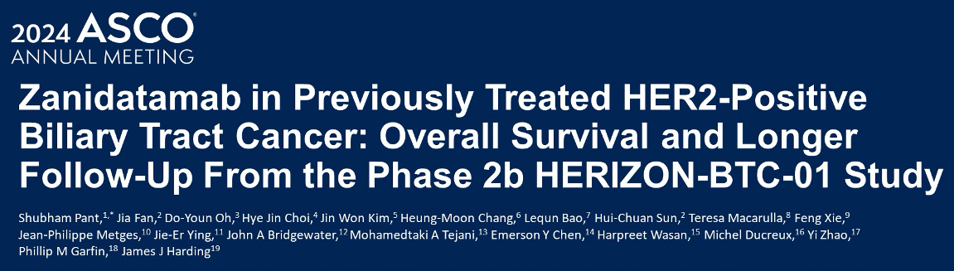
Abstract 4091

Slide 83
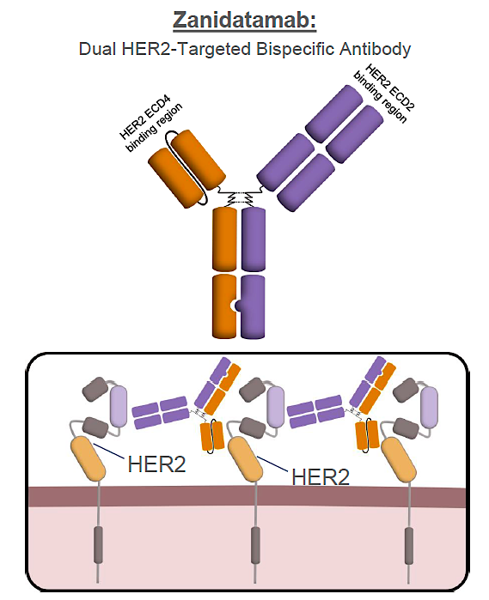
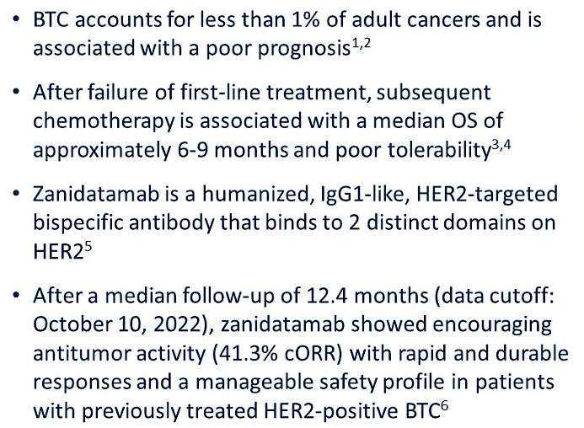
HERIZON-BTC-01: Zanidatamab Mechanism of Action and Study Background
cORR = confirmed objective response rate
Pant S et al. ASCO 2024;Abstract 4091; Rha SY et al. ESMO 2024;Abstract 516MO.

Slide 84
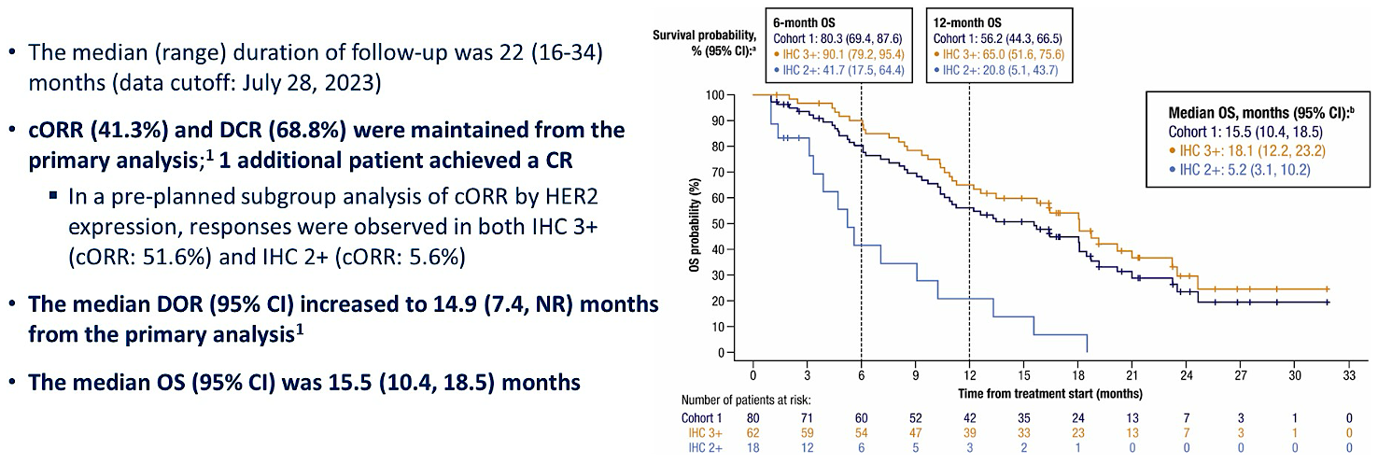
HERIZON-BTC-01: Long-Term Efficacy Outcomes
DCR = disease control rate; CR = complete response; DOR = duration of response; NR = not reached
Pant S et al. ASCO 2024;Abstract 4091.

Slide 85
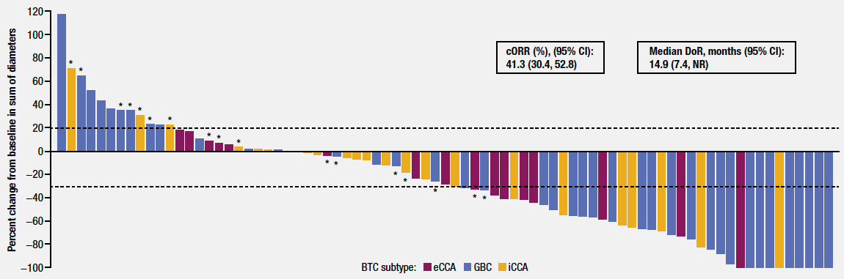
HERIZON-BTC-01: Target Lesion Reduction with Zanidatamab
eCCA = extrahepatic cholangiocarcinoma; GBC = gallbladder cancer; iCCA = intrahepatic cholangiocarcinoma
Pant S et al. ASCO 2024;Abstract 4091.

Slide 86
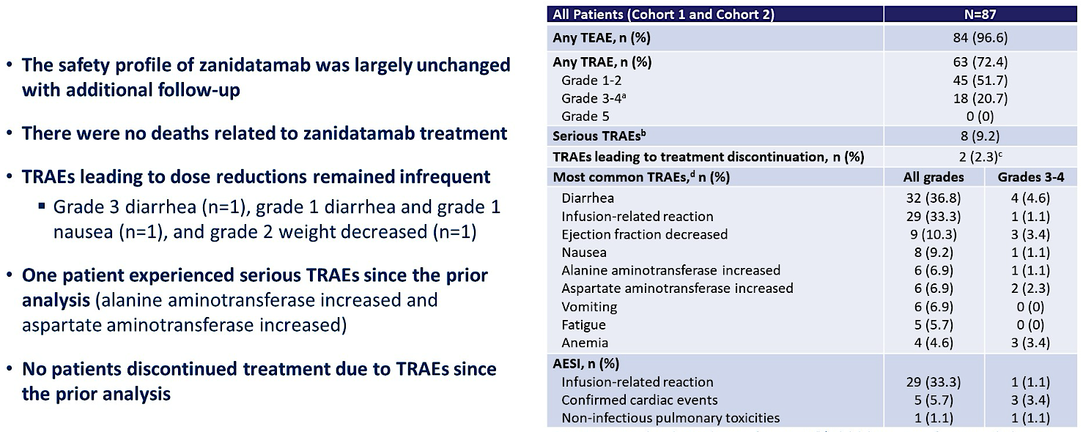
HERIZON-BTC-01: Long-Term Safety Outcomes
TRAE = treatment-related adverse event; TEAE = treatment-emergent adverse event; AESI = adverse event of special interest
Pant S et al. ASCO 2024;Abstract 4091.

Slide 87
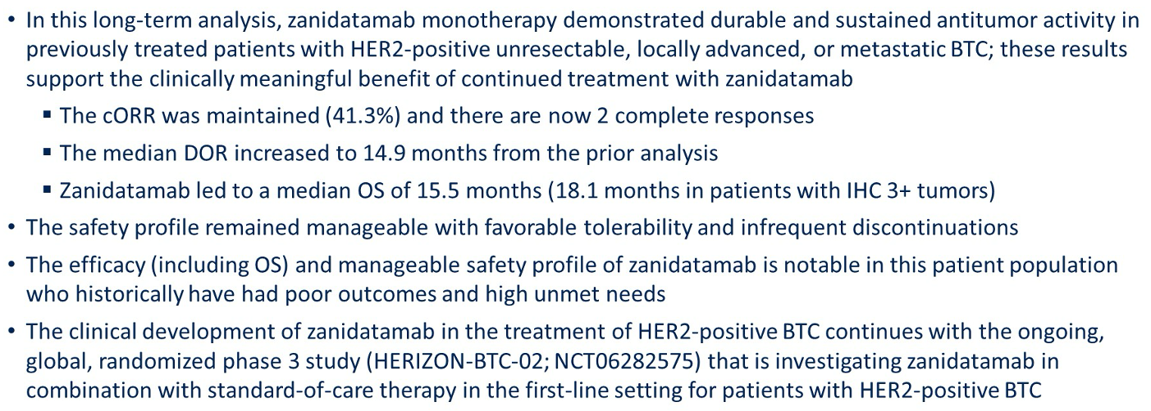
HERIZON-BTC-01: Author Conclusions
Pant S et al. ASCO 2024;Abstract 4091.

Slide 88
Zanidatamab Dose Optimization in Patients with HER2-Positive Biliary Tract Cancer
Trueman S et al.
Gastrointestinal Cancers Symposium 2025;Abstract 546.

Slide 89
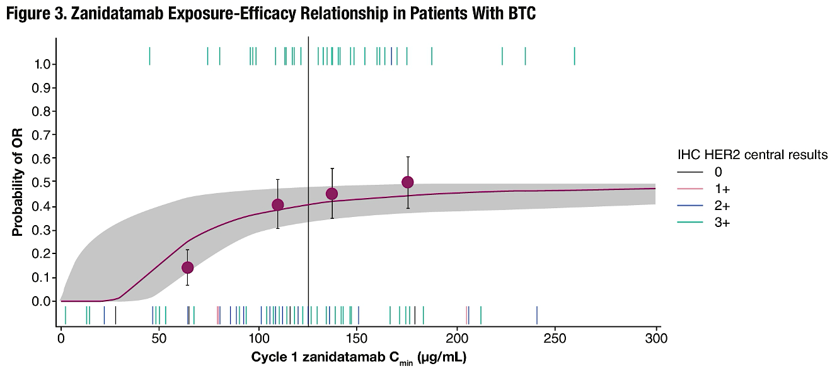
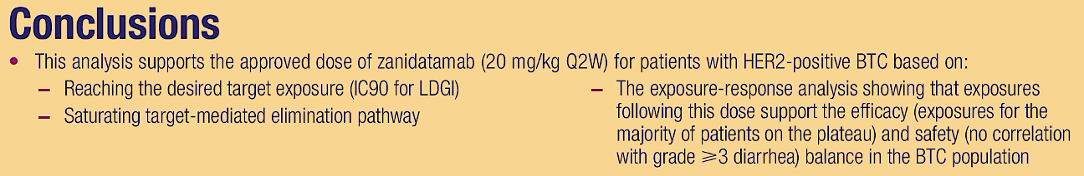
Zanidatamab Pharmacokinetics
Trueman S et al. Gastrointestinal Cancers Symposium 2025;Abstract 546.

Slide 90
Survival Outcomes for Zanidatamab-hrii Compared to Chemotherapy in Previously Treated HER2-Positive (IHC3+) Biliary Tract Cancer (BTC): HERIZON-BTC-01 vs a Real-World (RW) External Control Arm (ECA)
Kim RD et al.
ASCO 2025;Abstract 4101.

Slide 91
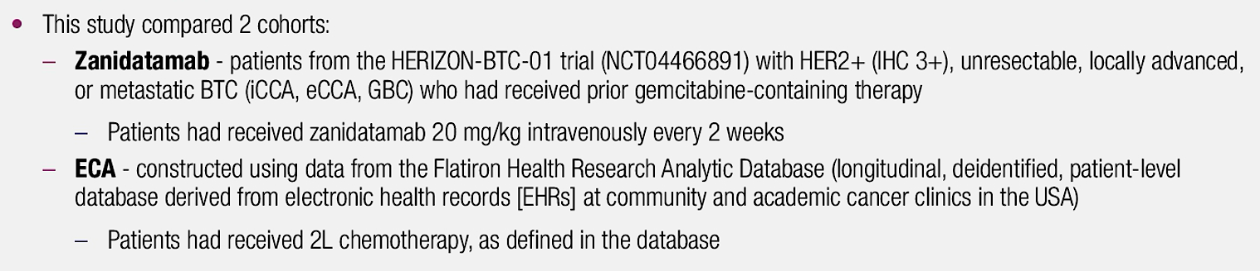
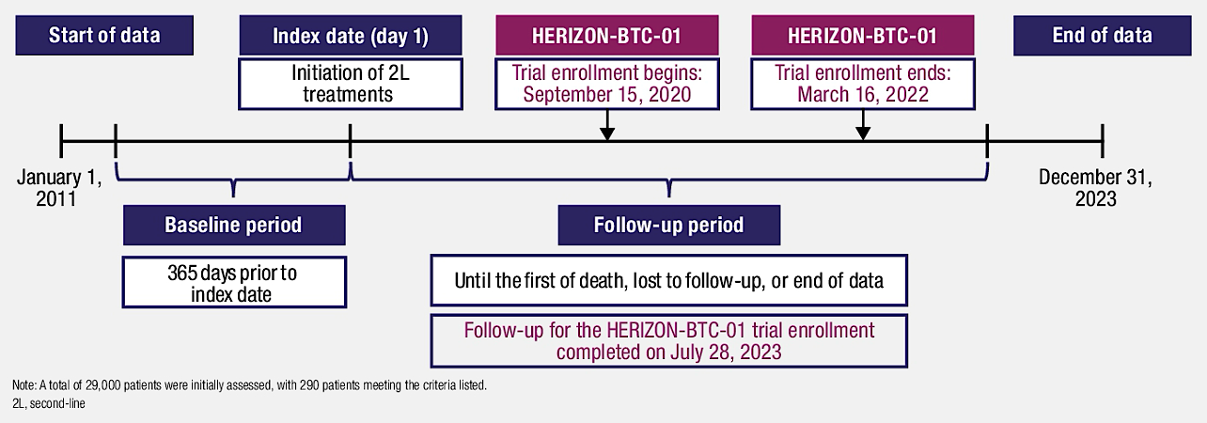
HERIZON-BTC-01 versus a Real-World External Control Arm (ECA)
Kim RD et al. ASCO 2025;Abstract 4101.

Slide 92
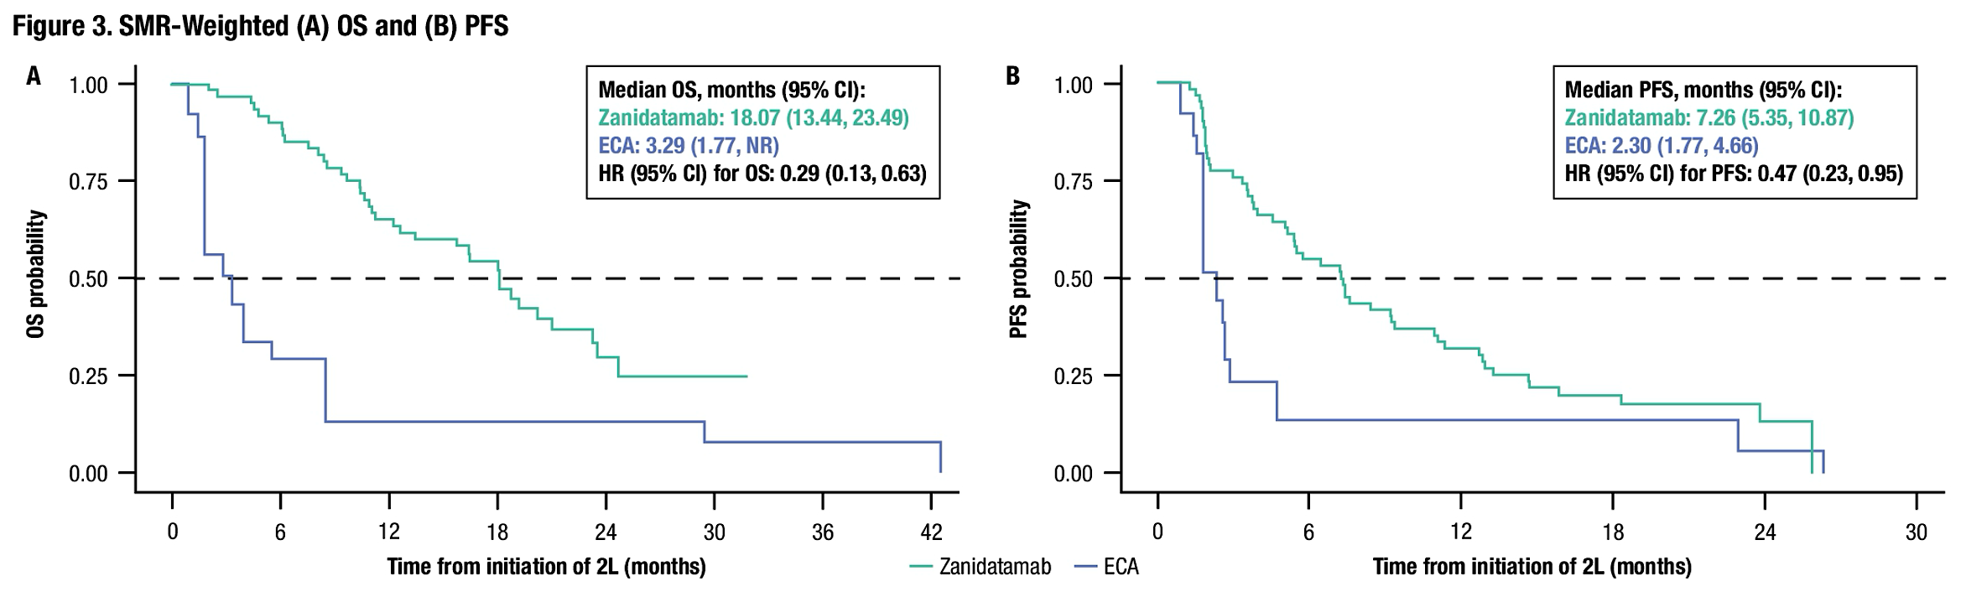
HERIZON-BTC-01 versus a Real-World ECA: Survival
SMR = standardized mortality ratio; OS = overall survival; PFS = progression-free survival
Kim RD et al. ASCO 2025;Abstract 4101.

Slide 93
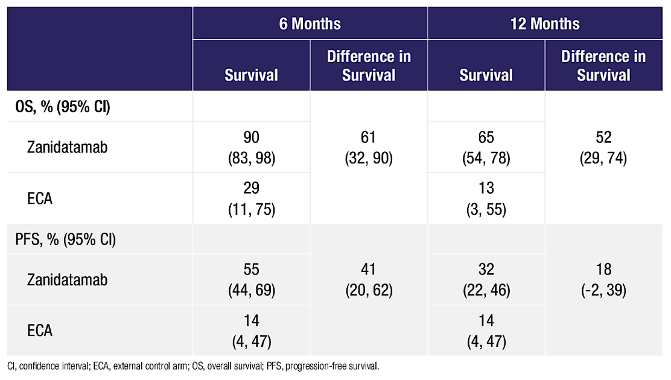
HERIZON-BTC-01 versus a Real-World ECA:
6-Month and 12-Month Outcomes
Kim RD et al. ASCO 2025;Abstract 4101.

Slide 94
Antitumour Activity and Safety of First-Line Zanidatamab + Cisplatin-Gemcitabine in Patients with HER2-Expressing Biliary Tract Cancer (BTC)
Oh D-Y et al.
ESMO GI 2025;Abstract 319P.

Slide 95
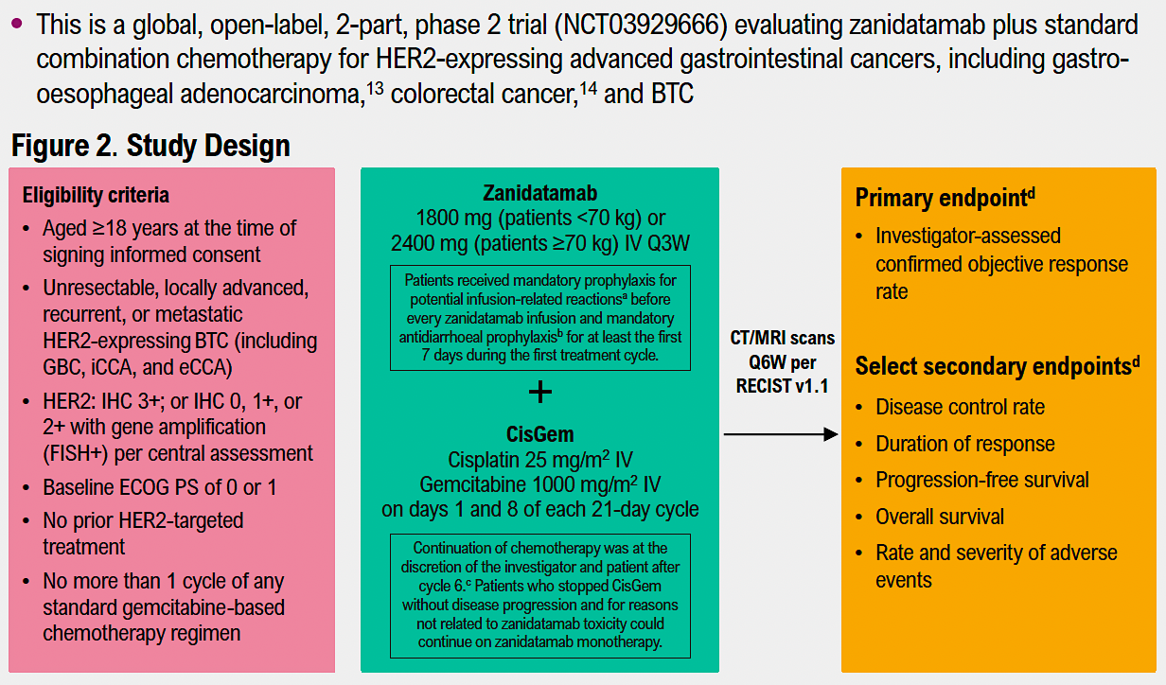
Phase II Study of First-Line Zanidatamab with Cisplatin/Gemcitabine
Oh D-Y et al. ESMO GI 2025;Abstract 319P.

Slide 96
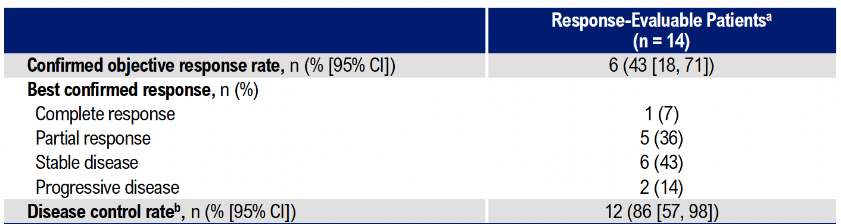
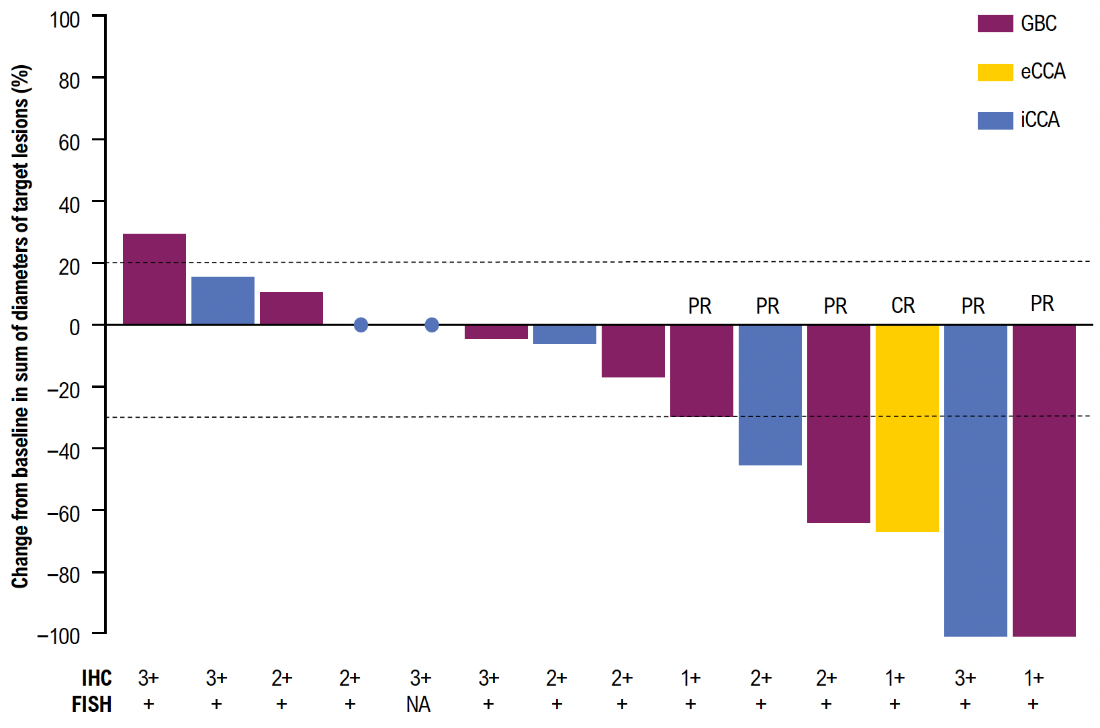
Phase II Study of First-Line Zanidatamab with Chemotherapy: Response
Oh D-Y et al. ESMO GI 2025;Abstract 319P.

Slide 97


Phase II Study of First-Line Zanidatamab with
Chemotherapy: PFS and OS
Oh D-Y et al. ESMO GI 2025;Abstract 319P.

Slide 98

Phase II Study of First-Line Zanidatamab with Chemotherapy: Safety
AEs = adverse events
Oh D-Y et al. ESMO GI 2025;Abstract 319P.

Slide 99
HERIZON-BTC-302: A Phase 3 Study of Zanidatamab with Standard-of-Care (SOC) Therapy vs SOC Alone for First-Line Treatment of Human Epidermal Growth Factor Receptor 2 (HER2)-Positive Advanced/ Metastatic Biliary Tract Cancer (BTC)
Harding JJ et al.
Gastrointestinal Cancers Symposium 2025;Abstract TPS648.

Slide 100

HERIZON-BTC-302: Ongoing Pivotal Phase III Trial Design
Harding JJ et al. Gastrointestinal Cancers Symposium 2025;Abstract TPS648.

Slide 101

Antibody-Drug Conjugate Trastuzumab Deruxtecan (T-DXd)
Smit EF et al. ASCO 2020;Abstract 9504.

Slide 102

J Clin Oncol 2024 January 1;42(1):47-58

Slide 103

DESTINY-PanTumor02: Response with T-DXd for Patients with HER2-Expressing Solid Tumors
ª Extramammary Paget disease, oropharyngeal neoplasm, head and neck cancer, and salivary gland cancer
Meric-Bernstam F et al. J Clin Oncol 2024 January 1;42(1):47-58.

Slide 104

DESTINY-PanTumor02: Maximum Change in Tumor Size with T-DXd for Patients with HER2-Expressing Solid Tumors
Meric-Bernstam F et al. J Clin Oncol 2024 January 1;42(1):47-58.

Slide 105

ASCO 2024

Slide 106

DESTINY-PanTumor02 Trial of T-DXd for Patients with
HER2-Expressing BTC and Pancreatic Cancer: ORR in the
BTC Cohort
ORR = objective response rate; IHC = immunohistochemistry; IO = immuno-oncology; IC = immune cells
Oh D-Y et al. ASCO 2024;Abstract 4090.

Slide 107
DESTINY-BTC01: An Ongoing Phase III Trial of First-Line T-DXd and Rilvegostomig versus Standard Therapy for Advanced HER2-Expressing BTC
Trial identifier: NCT06467357 (Open)
Estimated enrollment: 620
Arm A
T-DXd + rilvegostomig
Eligibility
Advanced or metastatic BTC or GBC No prior treatment in advanced or metastatic setting HER2 expressing (IHC 3+/2+)
Safety run-in
T-DXd 5.4 mg/kg + rilvegostomig 750 mg
q3w until PD
R
Arm B
T-DXd monotherapy
Arm C
Gemcitabine +
cisplatin or carboplatin
+ durvalumab
Primary endpoint, randomized portion:
Overall survival in HER2 IHC 3+ population
GBC = gallbladder cancer; PD = disease progression
Ikeda M et al. ESMO Asia Congress 2024;Abstract 261TiP; www.clinicaltrials.gov. Accessed August 2025.

Slide 108
Ongoing Phase III Trials Evaluating HER2-Targeted Strategies for Treatment-Naïve HER2-Positive Advanced BTC
Study | N | Eligibility | Randomization arms | Estimated primary completion
HERIZON-BTC-302 | 286 | Locally advanced unresectable or metastatic BTC No more than 2 cycles of systemic therapy with gemcitabine + platinum agent +/- PD-1/L1 inhibitor (durvalumab or pembrolizumab) No prior HER2-targeted agent | Zanidatamab + standard therapy Standard therapy | December 2028
DESTINY-BTC01 | 620 | Unresectable, previously untreated, locally advanced or metastatic BTC Histologically confirmed HER2-expressing (IHC 3+ or IHC 2+) BTC No prior HER2-targeted agent | T-DXd + rilvegostomig T-DXd Gemcitabine + platinum + durvalumab | June 2028
www.clinicaltrials.gov. Accessed August 2025.

Slide 109
Phase III TAB-2 Trial: First-Line Trastuzumab with Chemotherapy versus Chemotherapy Alone for HER2-Positive Advanced BTC
Trastuzumab 8 mg/kg q1d1 (IV)
6 mg/kg subsequent dosing q21d with chemotherapy
+
Gemcitabine + cisplatin OR gemcitabine + cisplatin +
nab paclitaxel
Key Eligibility Criteria
Age ≥18 years
Gallbladder cancer, intrahepatic cholangiocarcinoma or perihilar cholangiocarcinoma
HER2-positive by IHC or FISH
ECOG PS 0-2
Adjuvant chemotherapy permitted if completed ≥ 12 months prior to enrollment
R
N=70
Non-randomized
Gemcitabine + cisplatin OR gemcitabine + cisplatin +
nab paclitaxel
Primary Outcome Measure: Progression-free survival
IV = Intravenous; PS = performance status; PFS = progression-free survival
www.clinicaltrials.gov. NCT07062263. Accessed August 2025.

Slide 110
Agenda
Introduction: Is Biliary Tract Cancer (BTC) the New Non-Small Cell Lung Cancer? … Why?
Case 1: Do BTC Subtypes Respond Differently to Checkpoint Inhibitors?
Case 2: Anti-HER2-Directed Therapy for HER2-Low BTC?
Case 3: FGFR Inhibitors in the Front-Line Setting?
Case 4: Bone and Muscle Pain with an FGFR Inhibitor
Case 5: Improved Targeted Clinical Benefit for Specific FGFR Mutations?
Case 6: Sequencing of Available HER2-Targeted Agents
Case 7: IDH Inhibitors in Combination with Chemotherapy as Initial Therapy?
Case 8: BRAF and IDH Mutations — Which Targeted Treatment First?
Case 9: Measurable Residual Disease (MRD) as a Biomarker?

Slide 111
Case Presentation: 52-year-old man with hilar cholangiocarcinoma and PD s/p gemcitabine/capecitabine is found to have IDH1-mutant disease
Dr Shaachi Gupta (Lake Worth, Florida)

Slide 112
Agenda
Introduction: Is Biliary Tract Cancer (BTC) the New Non-Small Cell Lung Cancer? … Why?
Case 1: Do BTC Subtypes Respond Differently to Checkpoint Inhibitors?
Case 2: Anti-HER2-Directed Therapy for HER2-Low BTC?
Case 3: FGFR Inhibitors in the Front-Line Setting?
Case 4: Bone and Muscle Pain with an FGFR Inhibitor
Case 5: Improved Targeted Clinical Benefit for Specific FGFR Mutations?
Case 6: Sequencing of Available HER2-Targeted Agents
Case 7: IDH Inhibitors in Combination with Chemotherapy as Initial Therapy?
Case 8: BRAF and IDH Mutations — Which Targeted Treatment First?
Case 9: Measurable Residual Disease (MRD) as a Biomarker?

Slide 113
Case Presentation: 77-year-old man with IDH1- and
BRAF-mutant metastatic cholangiocarcinoma
Dr Philip Brooks (Brewer, Maine)

Slide 114
Agenda
Introduction: Is Biliary Tract Cancer (BTC) the New Non-Small Cell Lung Cancer? … Why?
Case 1: Do BTC Subtypes Respond Differently to Checkpoint Inhibitors?
Case 2: Anti-HER2-Directed Therapy for HER2-Low BTC?
Case 3: FGFR Inhibitors in the Front-Line Setting?
Case 4: Bone and Muscle Pain with an FGFR Inhibitor
Case 5: Improved Targeted Clinical Benefit for Specific FGFR Mutations?
Case 6: Sequencing of Available HER2-Targeted Agents
Case 7: IDH Inhibitors in Combination with Chemotherapy as Initial Therapy?
Case 8: BRAF and IDH Mutations — Which Targeted Treatment First?
Case 9: Measurable Residual Disease (MRD) as a Biomarker?

Slide 115
Case Presentation: 53-year-old man with recurrent metastatic cholangiocarcinoma with a BRAF V600E mutation receives dabrafenib/trametinib
Dr Farshid Dayyani (Orange, California)

Slide 116
Contributing Medical Oncologists
Warren S Brenner, MD
Lynn Cancer Institute
Boca Raton, Florida
Shaachi Gupta, MD, MPH Florida Cancer Specialists
Lake Worth, Florida
Philip L Brooks, MD
Northern Light Eastern Maine Medical Center and Lafayette Family Cancer Institute
Brewer, Maine
Kimberly Ku, MD
Illinois Cancer Care
Bloomington, Illinois
Farshid Dayyani, MD, PhD
Stern Center for Cancer Clinical Trials and Research
Orange, California
Joseph Martins, MD
UT Health Science Center
Tyler, Texas
Justin Peter Favaro, MD, PhD Oncology Specialists of Charlotte
Charlotte, North Carolina
Neil Morganstein, MD
Atlantic Health System
Summit, New Jersey

Slide 117
Cancer Q&A: Addressing Common Questions Posed by
Patients with Relapsed/Refractory Multiple Myeloma
A CME/MOC-Accredited Webinar Developed in Partnership with CancerCare®
Thursday, August 7, 2025
5:00 PM – 6:00 PM ET
Faculty
Natalie S Callander, MD
Sagar Lonial, MD, FACP
Moderator
Neil Love, MD

Slide 118
Thank you for joining us!
Please take a moment to complete the survey currently up on Zoom. Your feedback is very important to us.
The survey will remain open for
5 minutes after the meeting ends.
Information on how to obtain CME, ABIM MOC and ABS credit is provided in the Zoom chat room.
Attendees will also receive an email in 1 to 3 business days with these instructions.

