Slide 1
Addressing Current Knowledge and Practice Gaps in the Community — Optimizing the Use of Oral Selective Estrogen Receptor Degraders for Metastatic Breast Cancer — Part 1
A CME/MOC-Accredited Live Webinar
Tuesday, July 29, 2025
5:00 PM – 6:00 PM ET
Faculty
Komal Jhaveri, MD, FACP
Virginia Kaklamani, MD, DSc
Moderator
Neil Love, MD

Slide 2


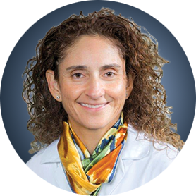
Faculty
Komal Jhaveri, MD, FACP
Patricia and James Cayne Chair for Junior Faculty
Associate Attending Physician
Breast Medicine Service and Early Drug Development Service
Section Head, Endocrine Therapy Research Program
Clinical Director, Early Drug Development Service
Department of Medicine
Memorial Sloan Kettering Cancer Center
Associate Professor of Medicine
Weill Cornell College of Medicine
New York, New York
MODERATOR
Neil Love, MD
Research To Practice
Miami, Florida
Virginia Kaklamani, MD, DSc
Professor of Medicine
Ruth McLean Bowman Bowers Chair in Breast Cancer Research and Treatment
AB Alexander Distinguished Chair in Oncology
Leader, Breast Oncology Program
UT Health San Antonio MD Anderson Cancer Center
San Antonio, Texas

Slide 3
Commercial Support
This activity is supported by an educational grant from Lilly.

Slide 4
Dr Love — Disclosures
Dr Love is president and CEO of Research To Practice. Research To Practice receives funds in the form of educational grants to develop CME activities from the following companies: Aadi Bioscience, AbbVie Inc, ADC Therapeutics, Alexion Pharmaceuticals, Amgen Inc, Array BioPharma Inc, a subsidiary of Pfizer Inc, Arvinas, Astellas, AstraZeneca Pharmaceuticals LP, Aveo Pharmaceuticals, Bayer HealthCare Pharmaceuticals, BeOne, Black Diamond Therapeutics Inc, Blueprint Medicines, Boehringer Ingelheim Pharmaceuticals Inc, Bristol Myers Squibb, Clovis Oncology, Coherus BioSciences, CTI BioPharma, a Sobi Company, Daiichi Sankyo Inc, Eisai Inc, Elevation Oncology Inc, Exact Sciences Corporation, Exelixis Inc, Genentech, a member of the Roche Group, Genmab US Inc, Geron Corporation, Gilead Sciences Inc, GSK, Hologic Inc, ImmunoGen Inc, Incyte Corporation, Ipsen Biopharmaceuticals Inc, Jazz Pharmaceuticals Inc, Johnson & Johnson, Karyopharm Therapeutics, Kite, A Gilead Company, Kura Oncology, Legend Biotech, Lilly, MEI Pharma Inc, Merck, Mersana Therapeutics Inc, Mirati Therapeutics Inc, Mural Oncology Inc, Natera Inc, Novartis, Novartis Pharmaceuticals Corporation on behalf of Advanced Accelerator Applications, Novocure Inc, Nuvalent, Pfizer Inc, Pharmacyclics LLC, an AbbVie Company, Puma Biotechnology Inc, Regeneron Pharmaceuticals Inc, Rigel Pharmaceuticals Inc, R-Pharm US, Sanofi, Seagen Inc, Servier Pharmaceuticals LLC, SpringWorks Therapeutics Inc, Stemline Therapeutics Inc, Syndax Pharmaceuticals, Taiho Oncology Inc, Takeda Pharmaceuticals USA Inc, TerSera Therapeutics LLC, and Tesaro, A GSK Company.

Slide 5
Research To Practice CME Planning Committee Members,
Staff and Reviewers
Planners, scientific staff and independent reviewers for Research To Practice have no relevant conflicts of interest to disclose.

Slide 6
Dr Jhaveri — Disclosures
Consultant/Advisory Board Roles | Arvinas, AstraZeneca Pharmaceuticals LP, Bicycle Therapeutics, Blueprint Medicines, Daiichi Sankyo Inc, Eisai Inc, Genentech, a member of the Roche Group, Gilead Sciences Inc, Halda Therapeutics, Loxo Oncology Inc, a wholly owned subsidiary of Eli Lilly & Company, Menarini Group, Merck, Novartis, Olema Oncology, Pfizer Inc, RayzeBio Inc, Scorpion Therapeutics, Stemline Therapeutics Inc, Zymeworks Inc
Research Funding Support to the Institution | AstraZeneca Pharmaceuticals LP, Blueprint Medicines, Eisai Inc, Genentech, a member of the Roche Group, Gilead Sciences Inc, Loxo Oncology Inc, a wholly owned subsidiary of Eli Lilly & Company, Merck, Novartis, Pfizer Inc, Puma Biotechnology Inc, RayzeBio Inc, Scorpion Therapeutics, Zymeworks Inc

Slide 7
Dr Kaklamani — Disclosures
Advisory Committees and Consulting Agreements | AstraZeneca Pharmaceuticals LP, Daiichi Sankyo Inc, Gilead Sciences Inc, Lilly, Menarini Group, Novartis, Pfizer Inc
Contracted Research | Eisai Inc
Speakers Bureaus | AstraZeneca Pharmaceuticals LP, Daiichi Sankyo Inc, Gilead Sciences Inc

Slide 8
This educational activity contains discussion of
non-FDA-approved uses of agents and regimens. Please refer to official prescribing information for each product for approved indications.

Slide 9
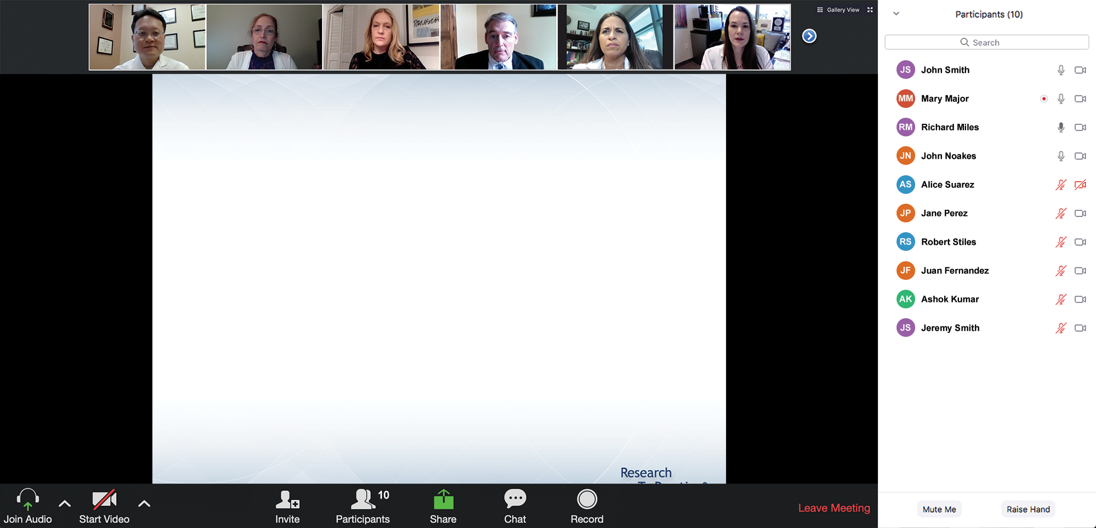

We Encourage Clinicians in Practice to Submit Questions
Feel free to submit questions now before the program begins and throughout the program.

Slide 10
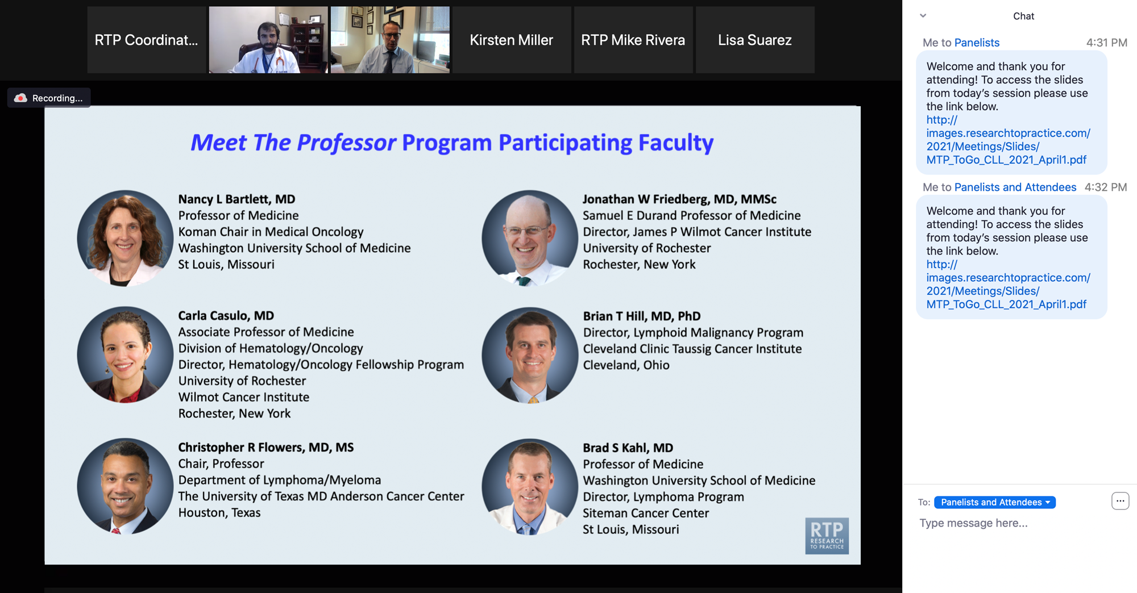
Familiarizing Yourself with the Zoom Interface
Expand chat submission box
Drag the white line above the submission box up to create
more space for your message.

Slide 11
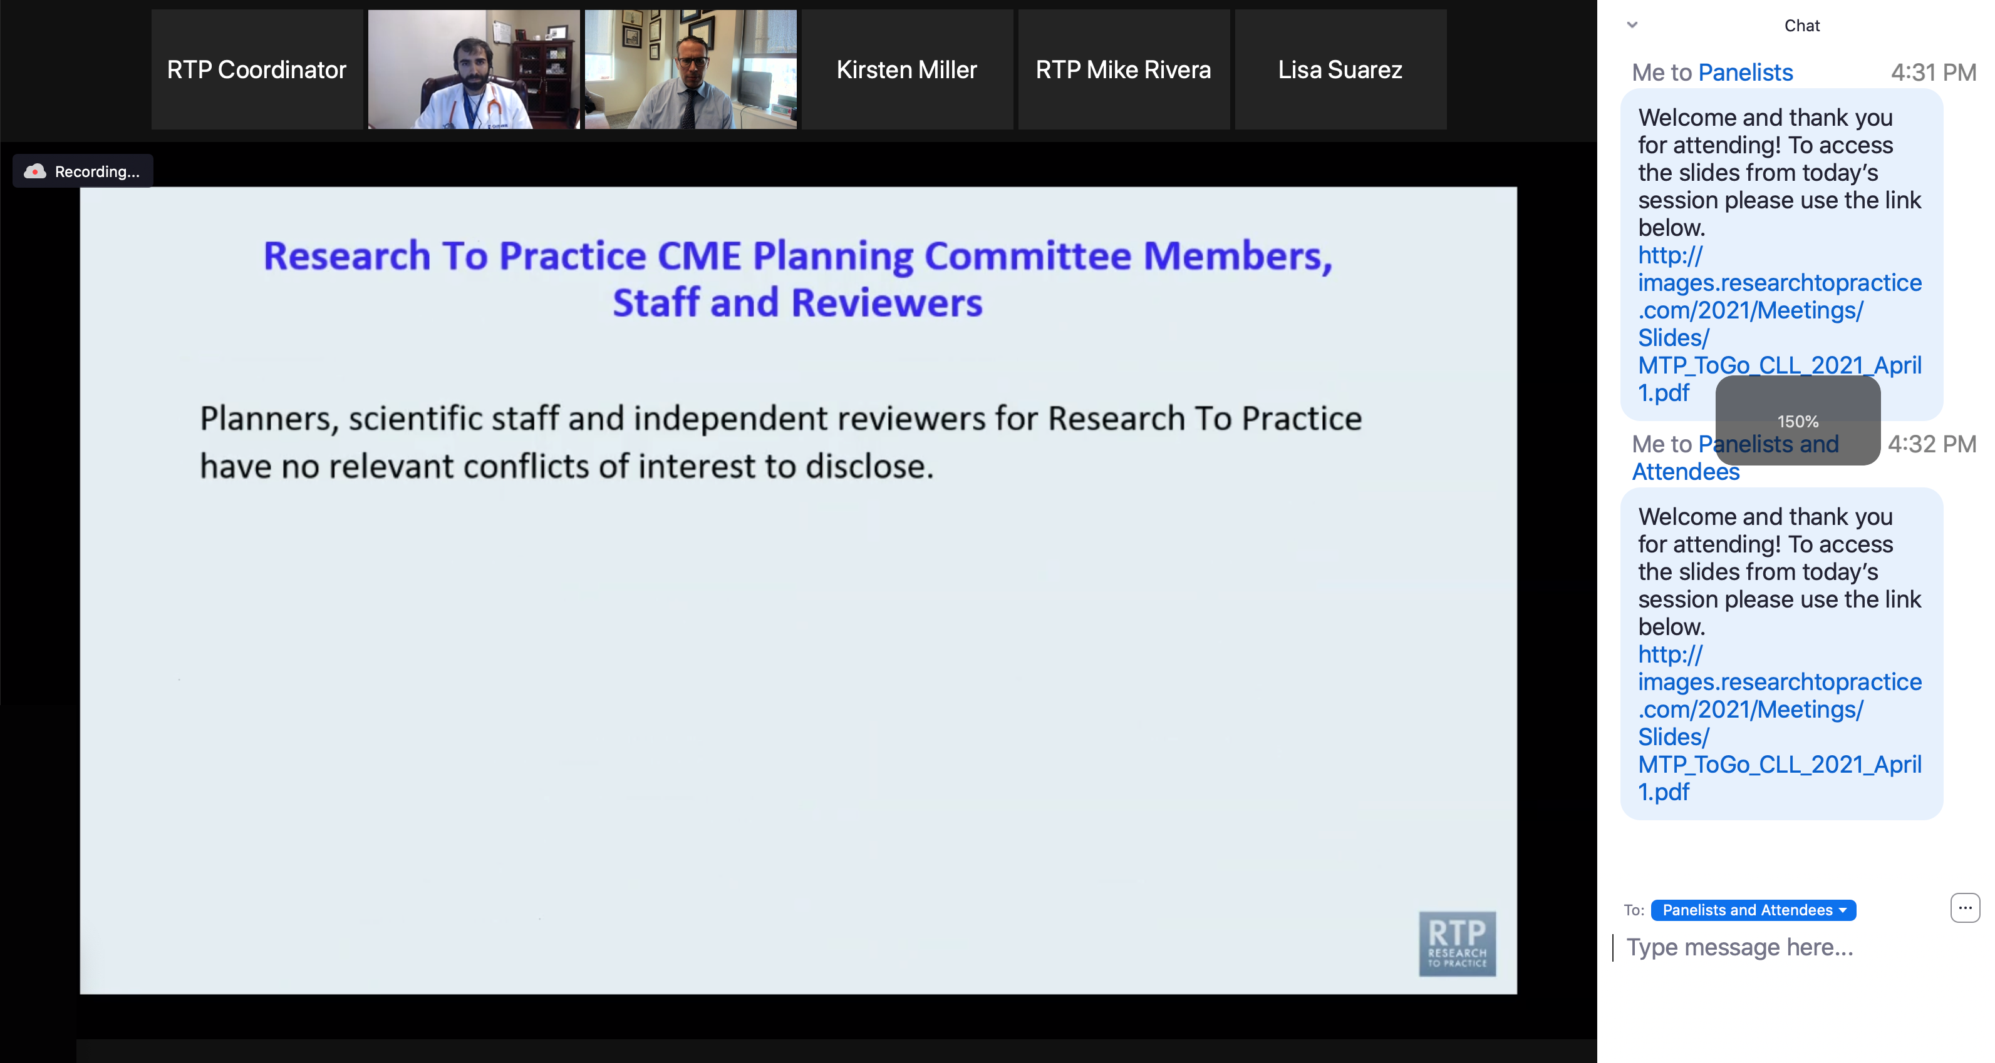
Familiarizing Yourself with the Zoom Interface
Increase chat font size
Press Command (for Mac) or Control (for PC) and the + symbol.
You may do this as many times as you need for readability.

Slide 12
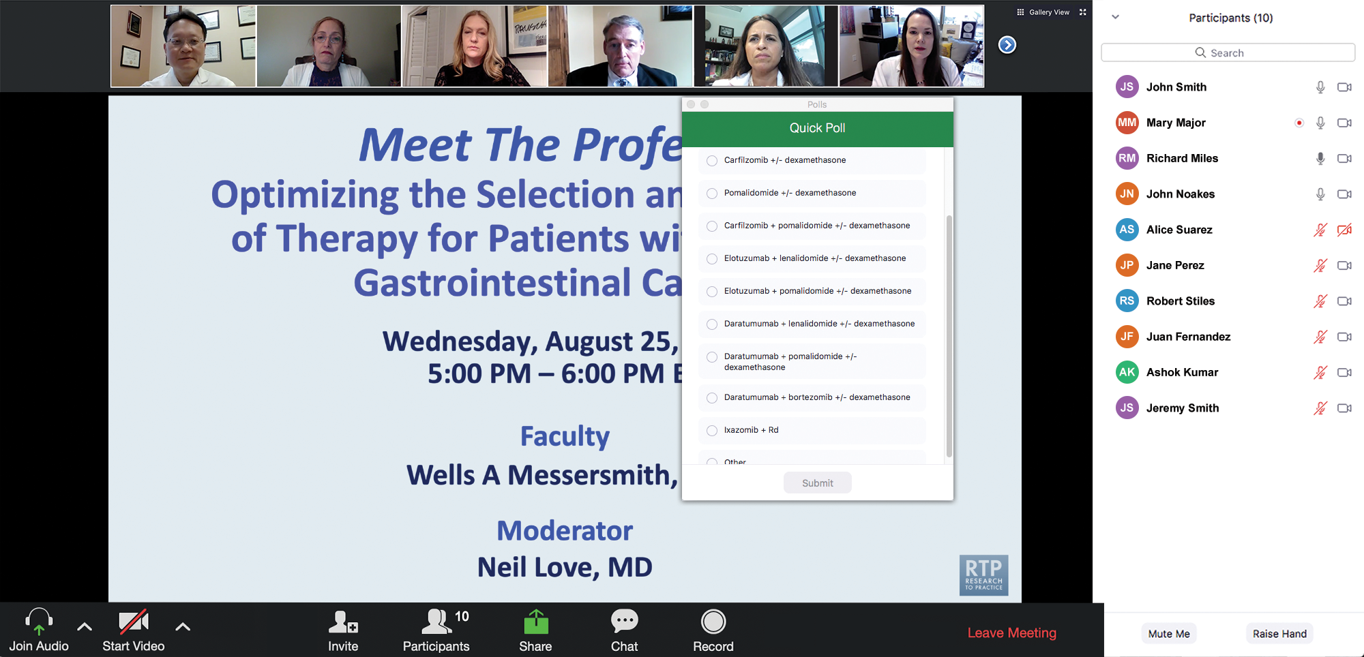
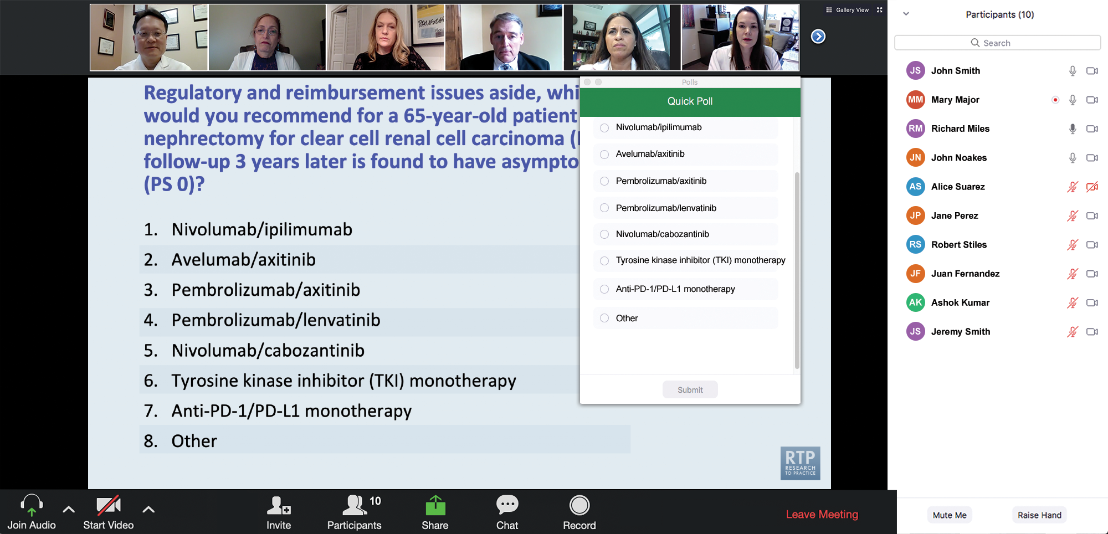
Clinicians in the Audience, Please Complete the Pre- and Postmeeting Surveys
Quick Survey
Quick Poll

Slide 13


Slide 14
Practical Perspectives: Experts Review
Actual Cases of Patients with Biliary Tract Cancers
A CME/MOC-Accredited Live Webinar
Wednesday, August 6, 2025
5:00 PM – 6:00 PM ET
Faculty
Haley Ellis, MD
James J Harding, MD
Moderator
Neil Love, MD

Slide 15
Cancer Q&A: Addressing Common Questions Posed by
Patients with Relapsed/Refractory Multiple Myeloma
A CME/MOC-Accredited Webinar Developed in Partnership with CancerCare®
Thursday, August 7, 2025
5:00 PM – 6:00 PM ET
Faculty
Natalie S Callander, MD
Sagar Lonial, MD, FACP
Moderator
Neil Love, MD

Slide 16
The Implications of Recent Datasets for the Current and
Future Management of Breast Cancer — An ASCO 2025 Review
A CME/MOC-Accredited Live Webinar
Wednesday, August 13, 2025
5:00 PM – 6:00 PM ET
Faculty
Sara A Hurvitz, MD, FACP
Sara M Tolaney, MD, MPH
Moderator
Neil Love, MD

Slide 17
Selection and Sequencing of Therapy for
Metastatic Triple-Negative Breast Cancer
A CME/MOC-Accredited Live Webinar
Thursday, August 28, 2025
5:00 PM – 6:00 PM ET
Faculty
Ana C Garrido-Castro, MD
Professor Peter Schmid, FRCP, MD, PhD
Moderator
Neil Love, MD

Slide 18
Consensus or Controversy? Clinical Investigators Provide Perspectives on the Current and Future Care of Patients with Relapsed/Refractory Multiple Myeloma
Part 1 of a 2-Part CME/MOC-, NCPD- and ACPE-Accredited Satellite Symposium Series During the Society of Hematologic Oncology 2025 Annual Meeting
Thursday, September 4, 2025
6:42 PM – 7:42 PM CT
Faculty
Meletios-Athanasios (Thanos) C Dimopoulos, MD
Hans Lee, MD
Noopur Raje, MD
Moderator
Joseph Mikhael, MD, MEd

Slide 19
Consensus or Controversy? Clinical Investigators
Provide Perspectives on the Current and Future Care of Patients with Follicular Lymphoma
Part 2 of a 2-Part CME/MOC-, NCPD- and ACPE-Accredited Satellite Symposium Series During the Society of Hematologic Oncology 2025 Annual Meeting
Friday, September 5, 2025
11:47 AM – 12:47 PM CT
Faculty
Jennifer Crombie, MD
Laurie H Sehn, MD, MPH
Moderator
Jeremy S Abramson, MD, MMSc

Slide 20
Thank you for joining us! Please take a moment to complete the survey currently up on Zoom.
Your feedback is very important to us.
Information on how to obtain CME, ABIM MOC and ABS credit will be provided at the conclusion of the activity in the Zoom chat room. Attendees will also receive an email in 1 to 3 business days with these instructions.

Slide 21
Addressing Current Knowledge and Practice Gaps in the Community — Optimizing the Use of Oral Selective Estrogen Receptor Degraders for Metastatic Breast Cancer — Part 1
A CME/MOC-Accredited Live Webinar
Tuesday, July 29, 2025
5:00 PM – 6:00 PM ET
Faculty
Komal Jhaveri, MD, FACP
Virginia Kaklamani, MD, DSc
Moderator
Neil Love, MD

Slide 22
Faculty
Komal Jhaveri, MD, FACP
Patricia and James Cayne Chair for Junior Faculty
Associate Attending Physician
Breast Medicine Service and Early Drug Development Service
Section Head, Endocrine Therapy Research Program
Clinical Director, Early Drug Development Service
Department of Medicine
Memorial Sloan Kettering Cancer Center
Associate Professor of Medicine
Weill Cornell College of Medicine
New York, New York
MODERATOR
Neil Love, MD
Research To Practice
Miami, Florida
Virginia Kaklamani, MD, DSc
Professor of Medicine
Ruth McLean Bowman Bowers Chair in Breast Cancer Research and Treatment
AB Alexander Distinguished Chair in Oncology
Leader, Breast Oncology Program
UT Health San Antonio MD Anderson Cancer Center
San Antonio, Texas

Slide 23
We Encourage Clinicians in Practice to Submit Questions
Feel free to submit questions now before the program begins and throughout the program.

Slide 24
Clinicians in the Audience, Please Complete the Pre- and Postmeeting Surveys
Quick Survey
Quick Poll

Slide 26
Practical Perspectives: Experts Review
Actual Cases of Patients with Biliary Tract Cancers
A CME/MOC-Accredited Live Webinar
Wednesday, August 6, 2025
5:00 PM – 6:00 PM ET
Faculty
Haley Ellis, MD
James J Harding, MD
Moderator
Neil Love, MD

Slide 27
Cancer Q&A: Addressing Common Questions Posed by
Patients with Relapsed/Refractory Multiple Myeloma
A CME/MOC-Accredited Webinar Developed in Partnership with CancerCare®
Thursday, August 7, 2025
5:00 PM – 6:00 PM ET
Faculty
Natalie S Callander, MD
Sagar Lonial, MD, FACP
Moderator
Neil Love, MD

Slide 28
The Implications of Recent Datasets for the Current and
Future Management of Breast Cancer — An ASCO 2025 Review
A CME/MOC-Accredited Live Webinar
Wednesday, August 13, 2025
5:00 PM – 6:00 PM ET
Faculty
Sara A Hurvitz, MD, FACP
Sara M Tolaney, MD, MPH
Moderator
Neil Love, MD

Slide 29
Selection and Sequencing of Therapy for
Metastatic Triple-Negative Breast Cancer
A CME/MOC-Accredited Live Webinar
Thursday, August 28, 2025
5:00 PM – 6:00 PM ET
Faculty
Ana C Garrido-Castro, MD
Professor Peter Schmid, FRCP, MD, PhD
Moderator
Neil Love, MD

Slide 30
Consensus or Controversy? Clinical Investigators Provide Perspectives on the Current and Future Care of Patients with Relapsed/Refractory Multiple Myeloma
Part 1 of a 2-Part CME/MOC-, NCPD- and ACPE-Accredited Satellite Symposium Series During the Society of Hematologic Oncology 2025 Annual Meeting
Thursday, September 4, 2025
6:42 PM – 7:42 PM CT
Faculty
Meletios-Athanasios (Thanos) C Dimopoulos, MD
Hans Lee, MD
Noopur Raje, MD
Moderator
Joseph Mikhael, MD, MEd

Slide 31
Consensus or Controversy? Clinical Investigators
Provide Perspectives on the Current and Future Care of Patients with Follicular Lymphoma
Part 2 of a 2-Part CME/MOC-, NCPD- and ACPE-Accredited Satellite Symposium Series During the Society of Hematologic Oncology 2025 Annual Meeting
Friday, September 5, 2025
11:47 AM – 12:47 PM CT
Faculty
Jennifer Crombie, MD
Laurie H Sehn, MD, MPH
Moderator
Jeremy S Abramson, MD, MMSc

Slide 32
Striving for Consensus: Clinical Investigators Review the Current and Future Role of Oral Selective Estrogen Receptor Degraders in the Care of Patients with ER-Positive Metastatic Breast Cancer
A Clinical Investigator Think Tank and Enduring Audio/Video/Podcast Activity
Thursday, September 18, 2025
12:00 PM – 3:00 PM ET
Faculty
Francois-Clement Bidard, MD, PhD
Hope S Rugo, MD
Rebecca Shatsky, MD
Seth Wander, MD, PhD
Moderator
Neil Love, MD

Slide 33
Addressing Current Knowledge and Practice Gaps in the Community — Optimizing the Use of Oral Selective Estrogen
Receptor Degraders for Metastatic Breast Cancer — Part 2
A CME/MOC-Accredited Live Webinar
Wednesday, October 29, 2025
5:00 PM – 6:00 PM ET
Faculty
Rinath M Jeselsohn, MD
Joyce O’Shaughnessy, MD
Moderator
Neil Love, MD

Slide 34
Addressing Current Knowledge and Practice Gaps in the Community — Optimizing the Use of Oral Selective Estrogen Receptor Degraders for Metastatic Breast Cancer — Part 1
A CME/MOC-Accredited Live Webinar
Tuesday, July 29, 2025
5:00 PM – 6:00 PM ET
Faculty
Komal Jhaveri, MD, FACP
Virginia Kaklamani, MD, DSc
Moderator
Neil Love, MD

Slide 35
Dr Jhaveri — Disclosures
Consultant/Advisory Board Roles | Arvinas, AstraZeneca Pharmaceuticals LP, Bicycle Therapeutics, Blueprint Medicines, Daiichi Sankyo Inc, Eisai Inc, Genentech, a member of the Roche Group, Gilead Sciences Inc, Halda Therapeutics, Loxo Oncology Inc, a wholly owned subsidiary of Eli Lilly & Company, Menarini Group, Merck, Novartis, Olema Oncology, Pfizer Inc, RayzeBio Inc, Scorpion Therapeutics, Stemline Therapeutics Inc, Zymeworks Inc
Research Funding Support to the Institution | AstraZeneca Pharmaceuticals LP, Blueprint Medicines, Eisai Inc, Genentech, a member of the Roche Group, Gilead Sciences Inc, Loxo Oncology Inc, a wholly owned subsidiary of Eli Lilly & Company, Merck, Novartis, Pfizer Inc, Puma Biotechnology Inc, RayzeBio Inc, Scorpion Therapeutics, Zymeworks Inc

Slide 36
Dr Kaklamani — Disclosures
Advisory Committees and Consulting Agreements | AstraZeneca Pharmaceuticals LP, Daiichi Sankyo Inc, Gilead Sciences Inc, Lilly, Menarini Group, Novartis, Pfizer Inc
Contracted Research | Eisai Inc
Speakers Bureaus | AstraZeneca Pharmaceuticals LP, Daiichi Sankyo Inc, Gilead Sciences Inc

Slide 37
Dr Love — Disclosures
Dr Love is president and CEO of Research To Practice. Research To Practice receives funds in the form of educational grants to develop CME activities from the following companies: Aadi Bioscience, AbbVie Inc, ADC Therapeutics, Alexion Pharmaceuticals, Amgen Inc, Array BioPharma Inc, a subsidiary of Pfizer Inc, Arvinas, Astellas, AstraZeneca Pharmaceuticals LP, Aveo Pharmaceuticals, Bayer HealthCare Pharmaceuticals, BeOne, Black Diamond Therapeutics Inc, Blueprint Medicines, Boehringer Ingelheim Pharmaceuticals Inc, Bristol Myers Squibb, Clovis Oncology, Coherus BioSciences, CTI BioPharma, a Sobi Company, Daiichi Sankyo Inc, Eisai Inc, Elevation Oncology Inc, Exact Sciences Corporation, Exelixis Inc, Genentech, a member of the Roche Group, Genmab US Inc, Geron Corporation, Gilead Sciences Inc, GSK, Hologic Inc, ImmunoGen Inc, Incyte Corporation, Ipsen Biopharmaceuticals Inc, Jazz Pharmaceuticals Inc, Johnson & Johnson, Karyopharm Therapeutics, Kite, A Gilead Company, Kura Oncology, Legend Biotech, Lilly, MEI Pharma Inc, Merck, Mersana Therapeutics Inc, Mirati Therapeutics Inc, Mural Oncology Inc, Natera Inc, Novartis, Novartis Pharmaceuticals Corporation on behalf of Advanced Accelerator Applications, Novocure Inc, Nuvalent, Pfizer Inc, Pharmacyclics LLC, an AbbVie Company, Puma Biotechnology Inc, Regeneron Pharmaceuticals Inc, Rigel Pharmaceuticals Inc, R-Pharm US, Sanofi, Seagen Inc, Servier Pharmaceuticals LLC, SpringWorks Therapeutics Inc, Stemline Therapeutics Inc, Syndax Pharmaceuticals, Taiho Oncology Inc, Takeda Pharmaceuticals USA Inc, TerSera Therapeutics LLC, and Tesaro, A GSK Company.

Slide 38
Commercial Support
This activity is supported by an educational grant from Lilly.
Research To Practice CME Planning Committee Members,
Staff and Reviewers
Planners, scientific staff and independent reviewers for Research To Practice have no relevant conflicts of interest to disclose.

Slide 39
This educational activity contains discussion of
non-FDA-approved uses of agents and regimens. Please refer to official prescribing information for each product for approved indications.

Slide 40
Agenda
Introduction: ER-Positive Metastatic Breast Cancer — Bringing Research Data into Practice
Module 1: Key Issues from the General Medical Oncologists (GMO) Survey
Module 2: Faculty Cases and GMO Questions

Slide 41
Survey of 50 General
Medical Oncologists:
Breast Cancer
Survey Dates: 7/22/25 to 7/25/25

Slide 42
Agenda
Introduction: ER-Positive Metastatic Breast Cancer — Bringing Research Data into Practice
Module 1: Key Issues from GMO Survey
Module 2: Faculty Cases and GMO Questions

Slide 43

2024;21(10):743-61.

Slide 44
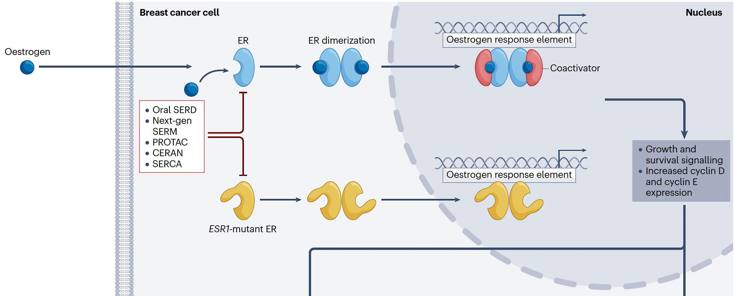
Overview of Biological Signaling in HR-Positive Breast Cancer
Lloyd MR et al. Nat Rev Clin Oncol 2024;21(10):743-61.

Slide 45
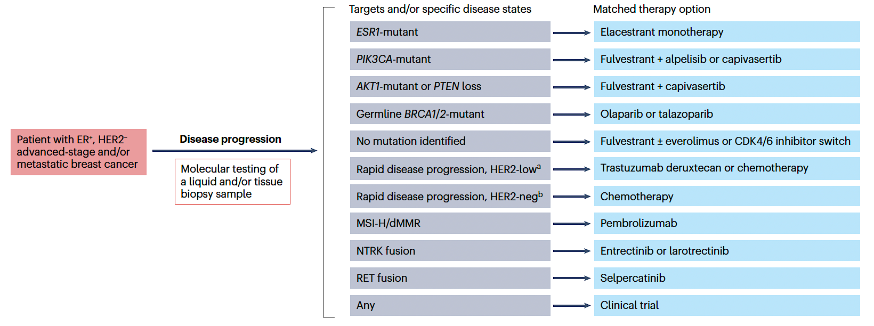
Targeted Selection of Second-Line or Later-Line Therapies for Patients with Metastatic ER-Positive Breast Cancer
Lloyd MR et al. Nat Rev Clin Oncol 2024;21(10):743-61.

Slide 46
Clinically Meaningful Improvement in Both Progession-Free Survival (PFS) Primary Endpoints in the PIK3CA Wild-Type Cohort of the Phase III VIKTORIA-1 Trial
Press Release: July 28, 2025
“[The manufacturer] today announced positive topline results from the PIK3CA wild-type cohort of the Phase 3 VIKTORIA-1 clinical trial evaluating gedatolisib plus fulvestrant with and without palbociclib versus fulvestrant in adults with hormone receptor (HR)-positive, human epidermal growth factor receptor 2 (HER2)-negative, PIK3CA wild-type, locally advanced or metastatic breast cancer, following progression on, or after, treatment with a CDK4/6 inhibitor and an aromatase inhibitor.
In the trial, the gedatolisib triplet demonstrated a statistically significant and clinically meaningful improvement in PFS among patients, reducing the risk of disease progression or death by 76% compared to fulvestrant (based on a hazard ratio [HR] of 0.24, 95% confidence interval [CI] 0.17-0.35; p < 0.0001). The mPFS, as assessed by blinded independent central review (‘BICR’), was 9.3 months with the gedatolisib triplet versus 2.0 months with fulvestrant, an incremental improvement of 7.3 months.
The gedatolisib doublet also demonstrated a statistically significant and clinically meaningful improvement in PFS among patients, reducing the risk of disease progression or death by 67% compared to fulvestrant (HR of 0.33, 95% CI 0.24-0.48; p < 0.0001). The mPFS, as assessed by BICR, was 7.4 months with the gedatolisib doublet versus 2.0 months with fulvestrant, an incremental improvement of 5.4 months.”
https://finance.yahoo.com/news/celcuity-announces-clinically-meaningful-improvement-110000421.html

Slide 47
Agenda
Introduction: ER-Positive Metastatic Breast Cancer — Bringing Research Data into Practice
Module 1: Key Issues from GMO Survey
Module 2: Faculty Cases and GMO Questions

Slide 48
Eleven Key Agents/Regimens for ER-Positive Breast Cancer
Agent | FDA status | Pivotal trial
Elacestrant | Approved (1/27/23) | EMERALD
Camizestrant | Investigational | SERENA-6
Imlunestrant | Investigational | EMBER-3
Alpelisib | Approved (5/24/2019) | SOLAR-1
Capivasertib | Approved (11/16/2023) | CAPItello-291
Inavolisib | Approved (10/10/2024) | INAVO120
Trastuzumab deruxtecan | Approved: HER2 low (8/5/2022) | DESTINY-Breast04
 | Approved: HER2 ultralow/low (1/27/2025) | DESTINY-Breast06
Datopotamab deruxtecan | Approved (1/17/2025) | TROPION-Breast01
Sacituzumab govitecan | Approved: HR-positive, HER2-negative (2/3/2023) | TROPiCS-02
PATINA regimen (palbociclib + trastuzumab ± pertuzumab + endocrine therapy) | Investigational | PATINA
Vepdegestrant | Investigational | VERITAC-2

Slide 49
Clinical Trials in ER-Positive Metastatic Breast Cancer
Clinical trial | Very familiar with | Very interested in learning about
EMERALD | 32% | 62%
SERENA-6 | 28% | 72%
EMBER-3 | 14% | 68%
SOLAR-1 | 30% | 42%
CAPItello-291 | 28% | 60%
INAVO120 | 16% | 70%
DESTINY-Breast04 | 40% | 58%
DESTINY-Breast06 | 32% | 64%
TROPION-Breast01 | 12% | 62%
TROPiCS-02 | 20% | 54%
PATINA | 18% | 68%
VERITAC-2 | 8% | 70%
Survey of 50 General Medical Oncologists July 2025

Slide 50
Educational Topics
Educational topics | Well informed about | Very interested in learning about
Incidence and clinical implications of ESR1 mutations in ER-positive metastatic breast cancer (mBC) | 30% | 78%
Best practices for detection of and monitoring for ESR1 mutations in patients with mBC | 30% | 66%
Comparison of available and investigational oral SERDs | 12% | 80%
Efficacy of available and investigational oral SERDs in patients with ER-positive, HER2-negative, ESR1-mutated mBC | 16% | 72%
Available trial data with oral SERDs-based combinations for patients with and without ESR1 mutations | 12% | 74%
Adverse effects of oral SERDs and strategies for prevention and management | 16% | 76%
Survey of 50 General Medical Oncologists July 2025

Slide 51
For approximately how many patients with breast cancer have you prescribed the following agents?
Agent | Median | Mean
Elacestrant | 5 | 7
Alpelisib | 2 | 6
Capivasertib | 2 | 5
Inavolisib | 0 | 2
Trastuzumab deruxtecan (for HER2-low or ultralow disease only) | 5 | 9
Datopotamab deruxtecan | 0 | 2
Sacituzumab govitecan | 5 | 8
Palbociclib + anti-HER2 therapy + ET | 1 | 4
ET = endocrine therapy
Survey of 50 General Medical Oncologists July 2025

Slide 52
Key Issues in Metastatic ER-Positive Breast Cancer
New Endocrine Agents
Elacestrant, imlunestrant, camizestrant, vepdegestrant,
alpelisib, inavolisib, capivasertib
New Antibody-Drug Conjugates (ADCs)
Sacituzumab govitecan, datopotamab deruxtecan, trastuzumab deruxtecan
Endocrine Treatment for HER2-Positive Disease
Palbociclib

Slide 53
Clinical Decision-Making in ER-Positive,
HER2-Low/IHC 0 Metastatic Disease
First-line treatment:
Selective estrogen receptor degrader (SERD) and CDK inhibitor? (Imlunestrant and abemaciclib)
Inavolisib/palbociclib/fulvestrant?
Monitor for ESR1 and treat? Camizestrant?
Second-line treatment:
Endocrine versus ADC? (Time on CDK inhibitor?)
– Choice of agent: elacestrant, imlunestrant, camizestrant, vepdegestrant, alpelisib, capivasertib or repeat CDK inhibitor?
– SERD and repeat CDK inhibitor (imlunestrant, abemaciclib)

Slide 54
Key Endocrine and SERD Questions in 2025 for ER-Positive, HER2-Low or HER2-Negative Disease
4 mutation subsets: ESR+/- or PIK3CA+/- (like ER/HER2)
Mechanism of action of SERDs
Endocrine treatment versus chemotherapy/ADC
Optimal SERD choice
PROTACs, SERMs, others?
Treating “molecular progression”
Eligibility for up-front inavolisib/palbociclib/fulvestrant (de novo? HbA1c?)
Role of CDKi after CDKi? (abemaciclib)
Role of CDKi with SERD (abemaciclib/imlunestrant)
SERD after AKTi and reverse?
CDKi (palbociclib) after first-line T-DXd (ESR1+, HER2+)?

Slide 55
Key Endocrine/SERD Questions 2025
Mechanism of action of SERDs

Slide 56
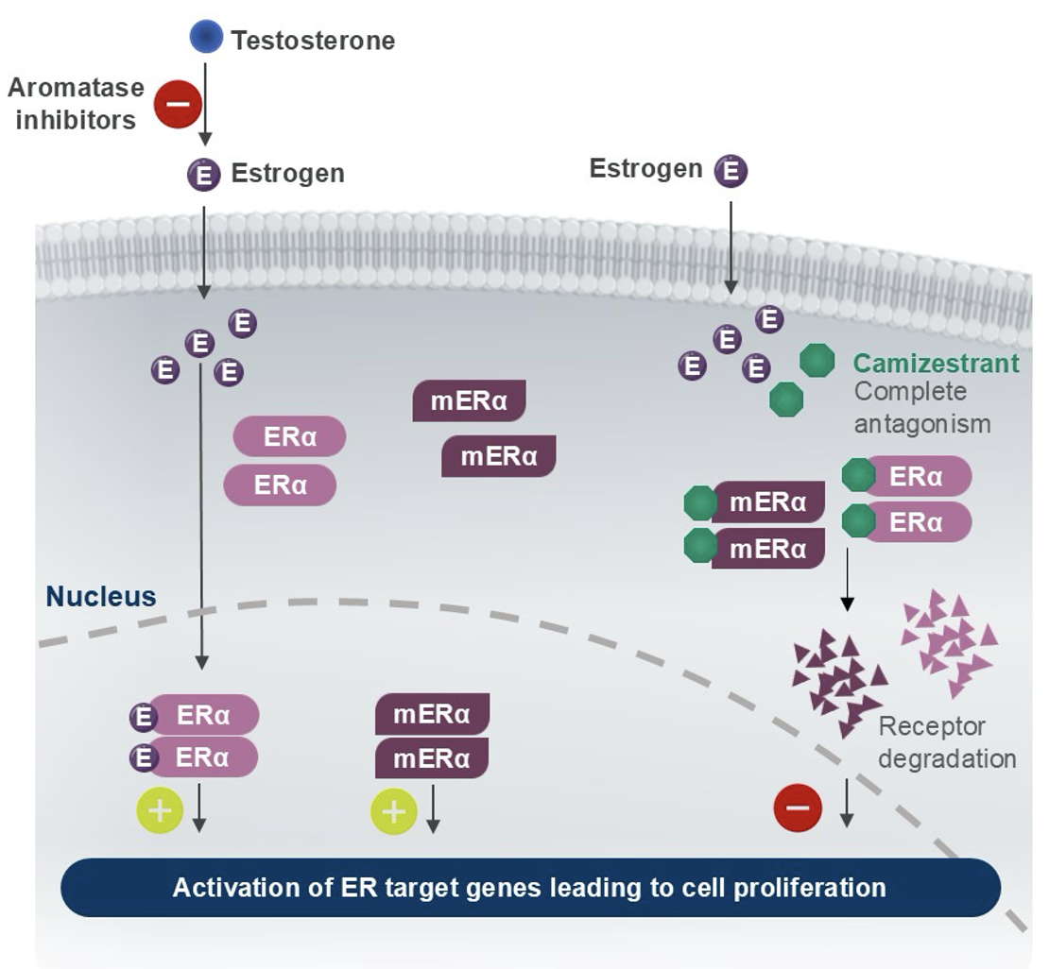
Mechanism of Action of Oral SERDs
Bidard F-C et al. N Engl J Med June 1, 2025;[Online ahead of print]. Turner N et al. ASCO 2025;Abstract LBA4.

Slide 57
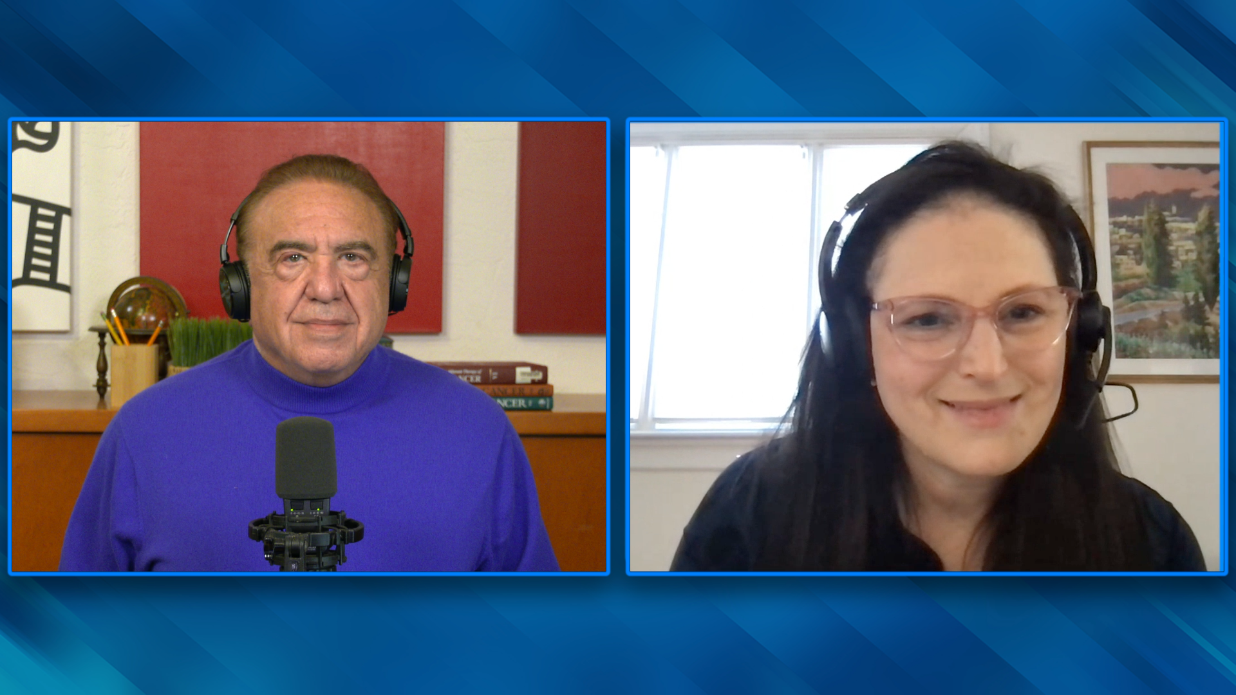

Slide 58
Key Endocrine/SERD Questions 2025
Endocrine treatment versus chemotherapy/ADC

Slide 59
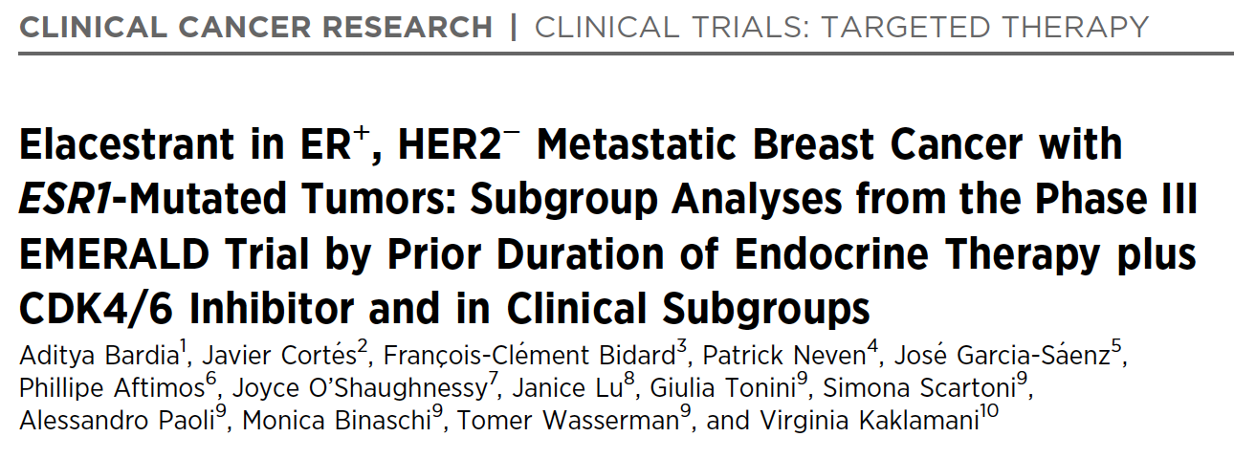
2024 August 1;[Online ahead of print].

Slide 60
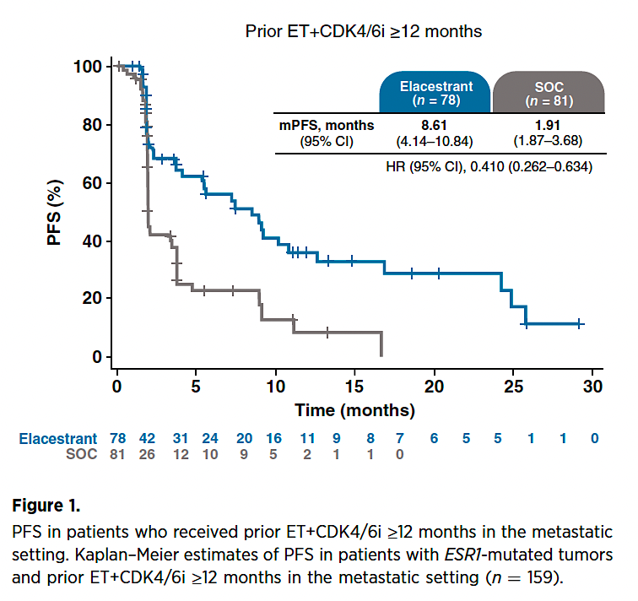
Elacestrant After ≥12 Months of Endocrine Therapy and CDK4/6 Inhibition
Bardia A et al. Clin Cancer Res 2024 August 1;[Online ahead of print].
mPFS = median progression-free survival

Slide 61
Key Endocrine/SERD Questions 2025
Optimal SERD choice

Slide 62
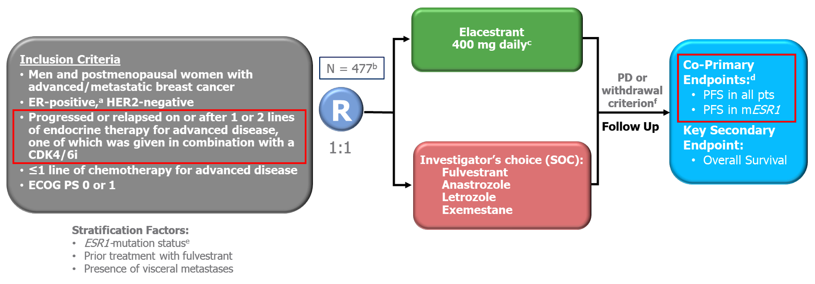
EMERALD Study Design
SOC = standard of care; PD = disease progression
Bardia A et al. SABCS 2021;Abstract GS2-02.

Slide 63
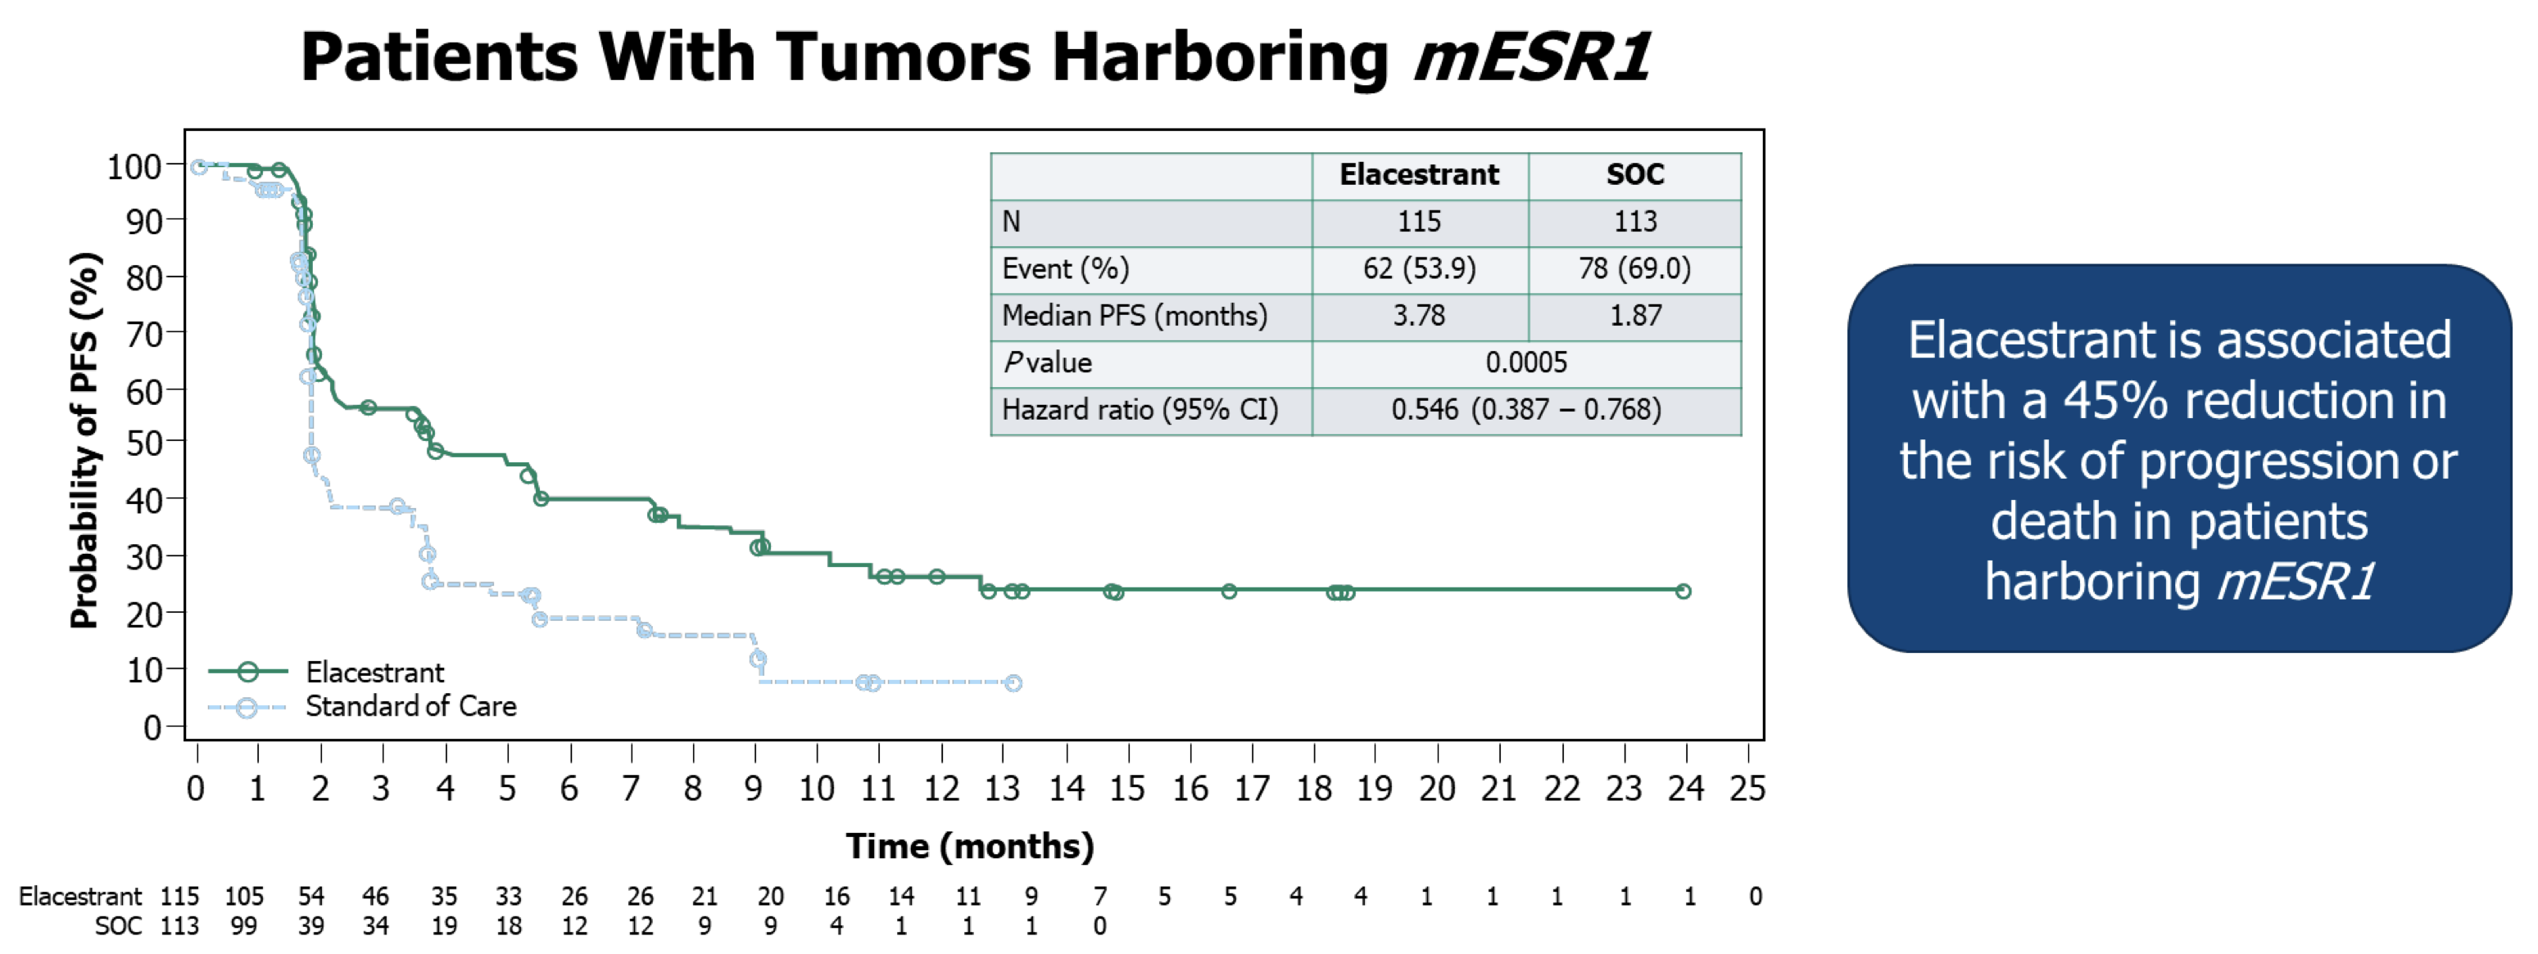
EMERALD: PFS for Patients with ESR1 Mutations (mESR1)
Bardia A et al. SABCS 2021;Abstract GS2-02.

Slide 64
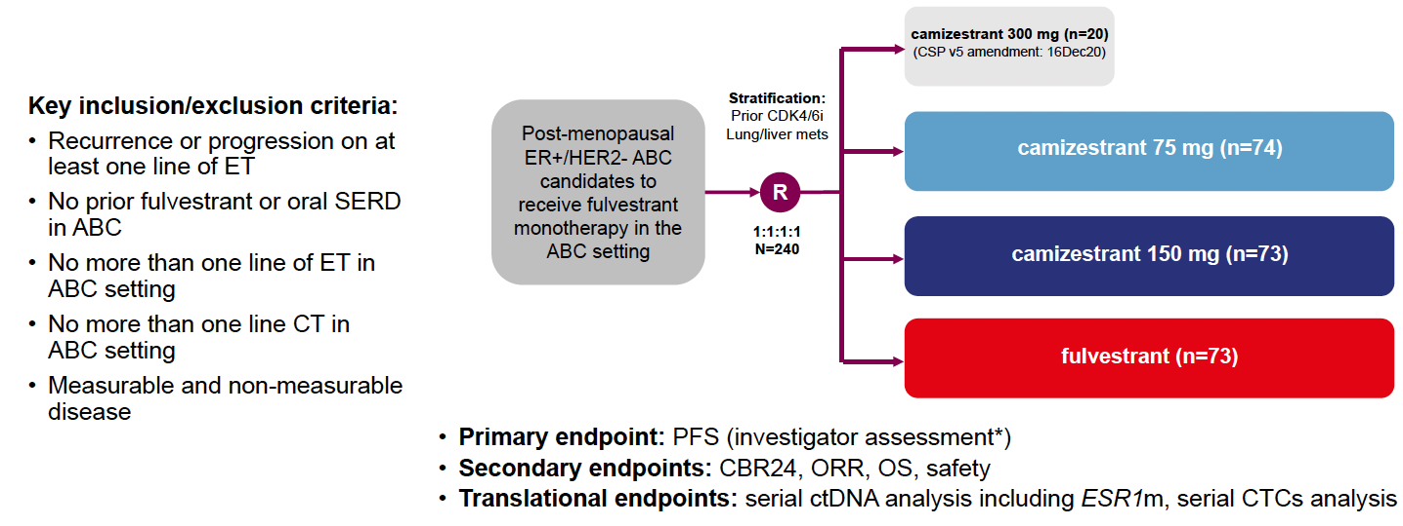
SERENA-2 Study Design
Oliveira M et al. Lancet Oncol 2024;25(11):1424-39; San Antonio Breast Cancer Symposium 2022;Abstract GS3-02.

Slide 65
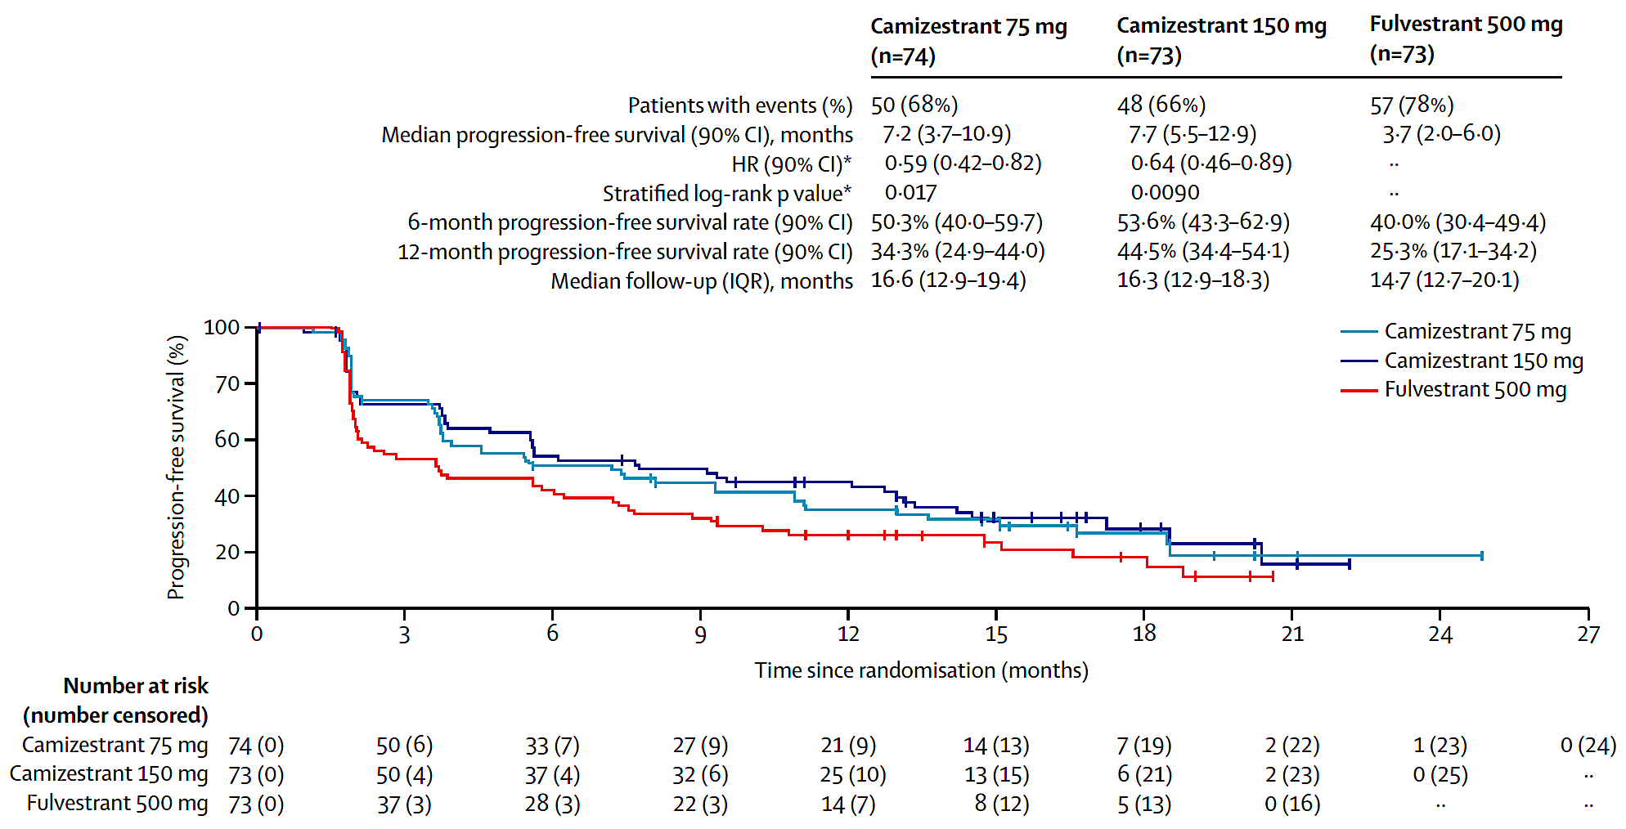
SERENA-2: PFS Outcomes
Oliveira M et al. Lancet Oncol 2024;25(11):1424-39.

Slide 66
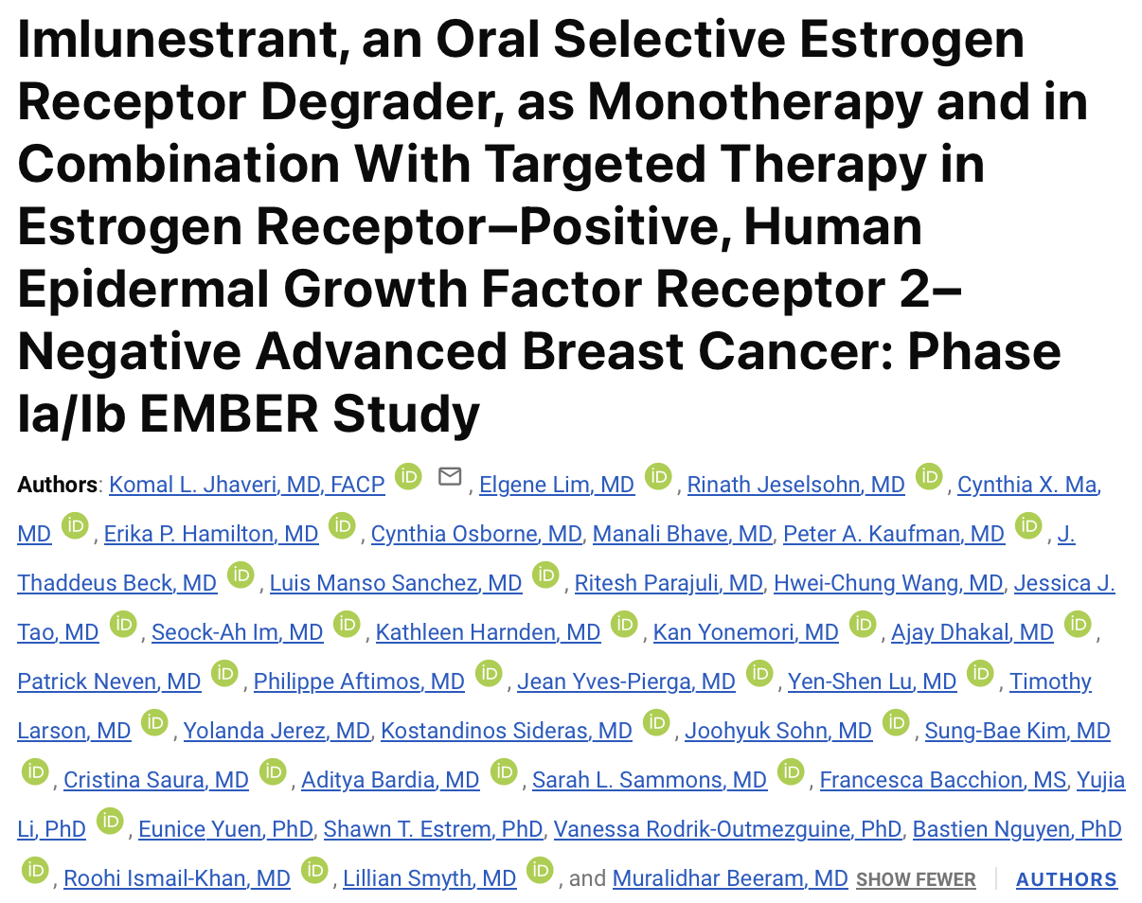
J Clin Oncol 2024;[Online ahead of print].

Slide 67
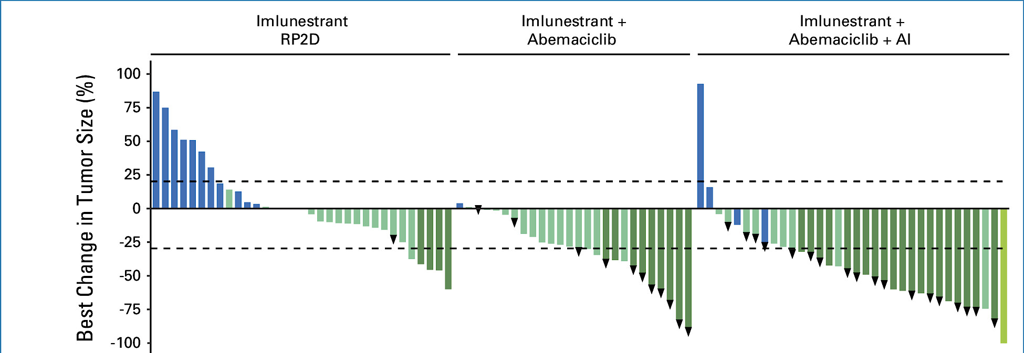
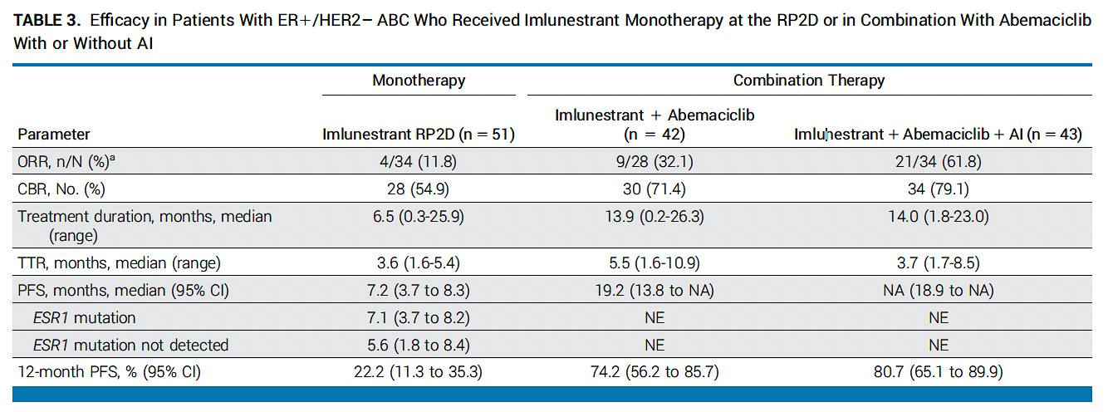
Phase Ia/Ib EMBER: Tumor Responses
RP2D = recommended Phase II dose;
AI = aromatase inhibitor; ORR = overall response rate; CBR = clinical benefit rate; TTR = time to response
Jhaveri KL et al.
J Clin Oncol 2024;[Online ahead of print].

Slide 68
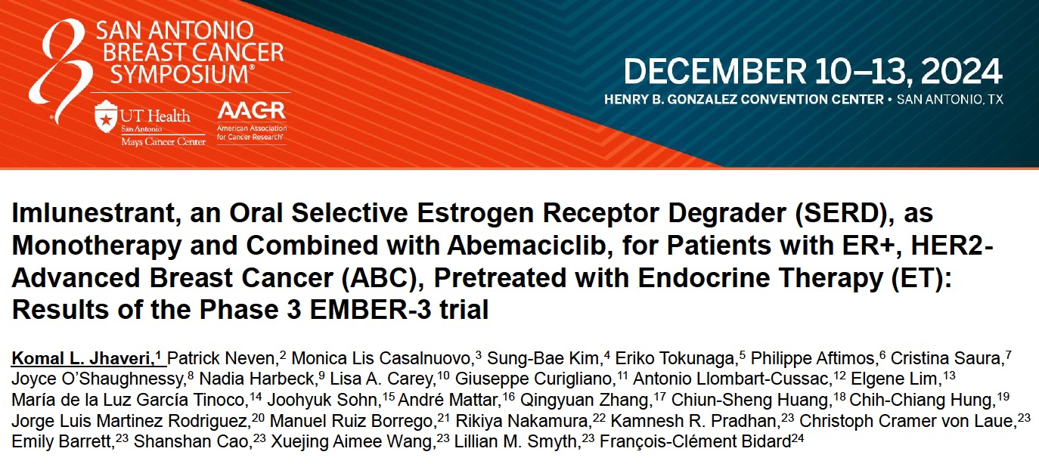
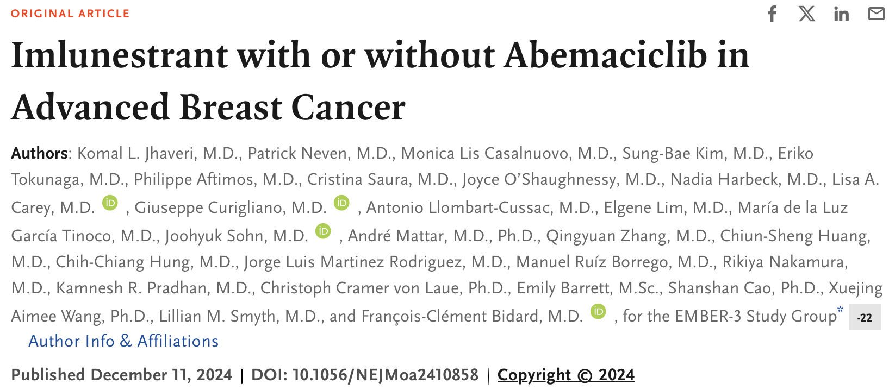
Abstract GS1-01

Slide 69
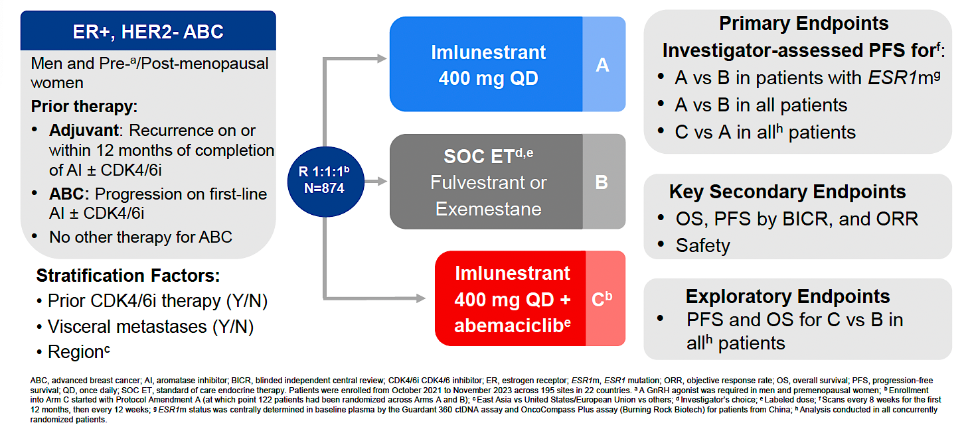
EMBER-3 Study Design
Jhaveri KL et al. San Antonio Breast Cancer Symposium 2024;Abstract GS1-01.

Slide 70
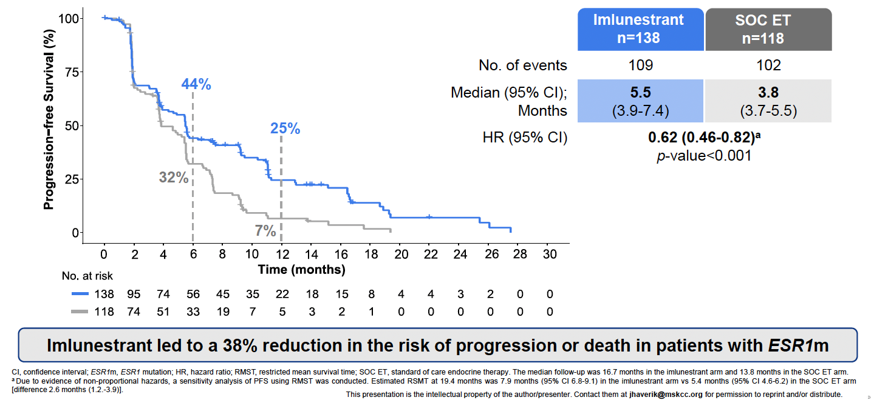
EMBER-3: PFS with Imlunestrant Monotherapy for Patients with ESR1 Mutations
Jhaveri KL et al. San Antonio Breast Cancer Symposium 2024;Abstract GS1-01.

Slide 71
Key Endocrine/SERD Questions 2025
PROTACs, SERMs, others?

Slide 72
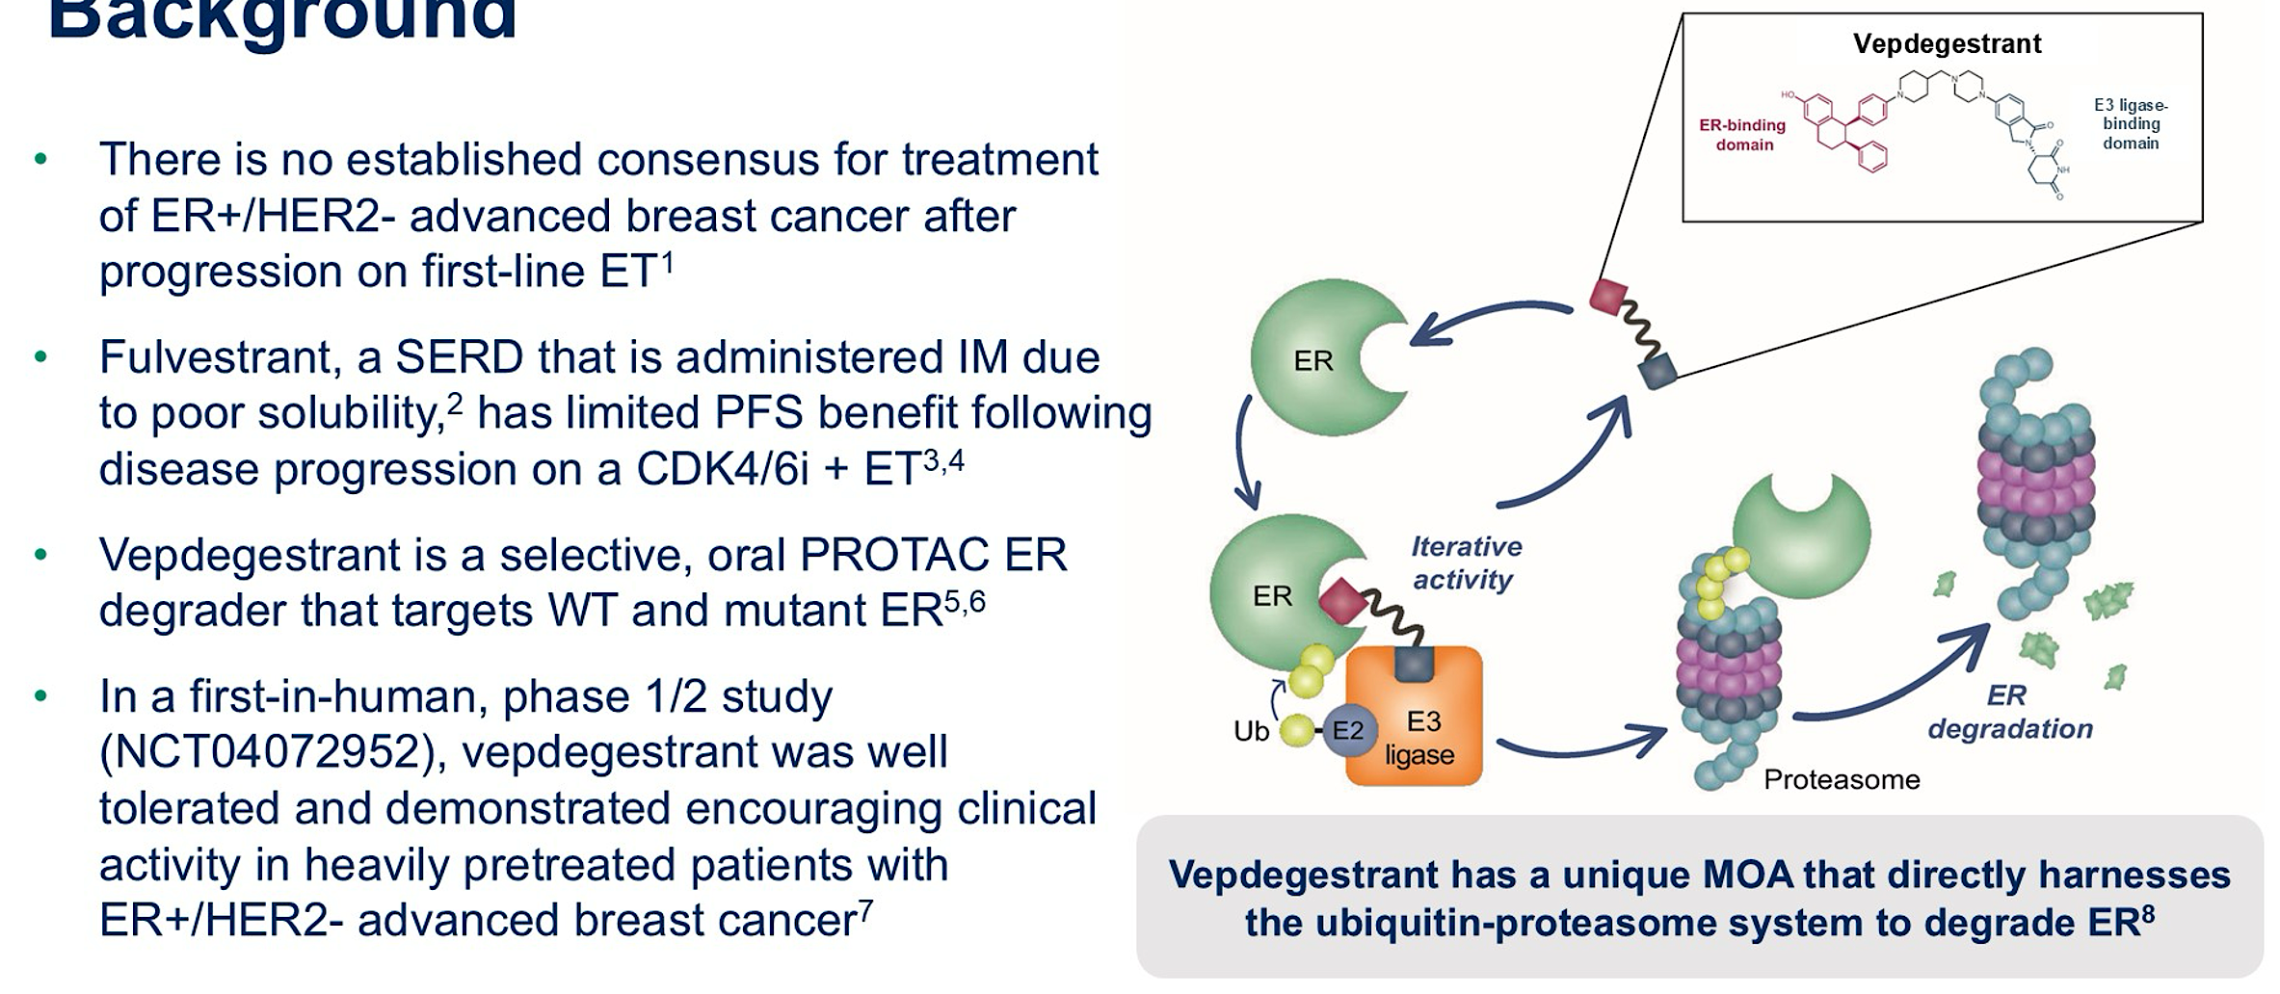
Background and Vepdegestrant Mechanism of Action
IM = intramuscularly; WT = wild type
Hamilton E et al. ASCO 2025;Abstract LBA1000.

Slide 73
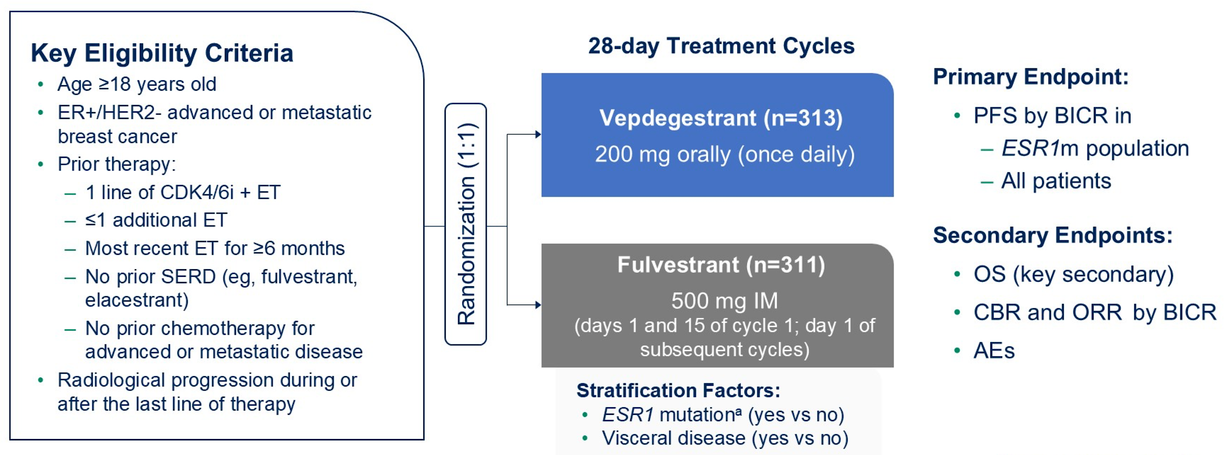
VERITAC-2 Study Design
Hamilton E et al. ASCO 2025;Abstract LBA1000.

Slide 74
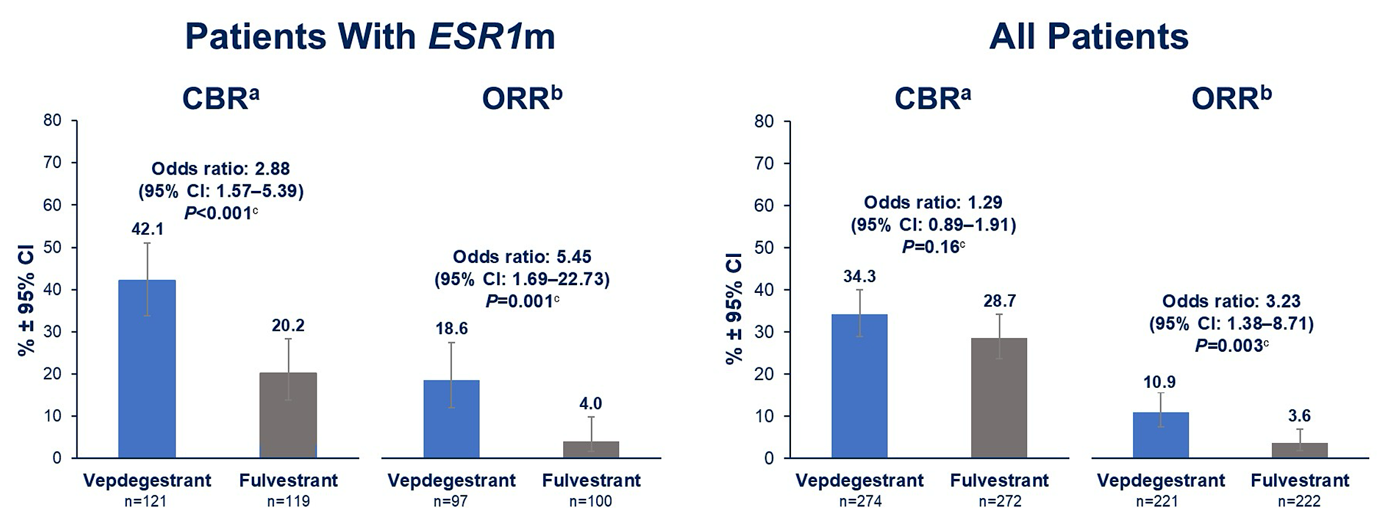
VERITAC-2: Response Data
Hamilton E et al. ASCO 2025;Abstract LBA1000.

Slide 75
Key Endocrine/SERD Questions 2025
Treating “molecular progression”

Slide 76
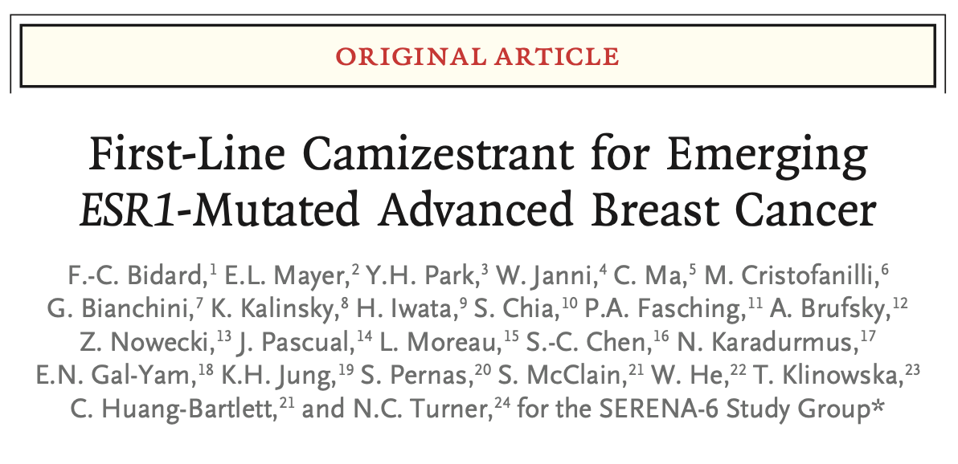
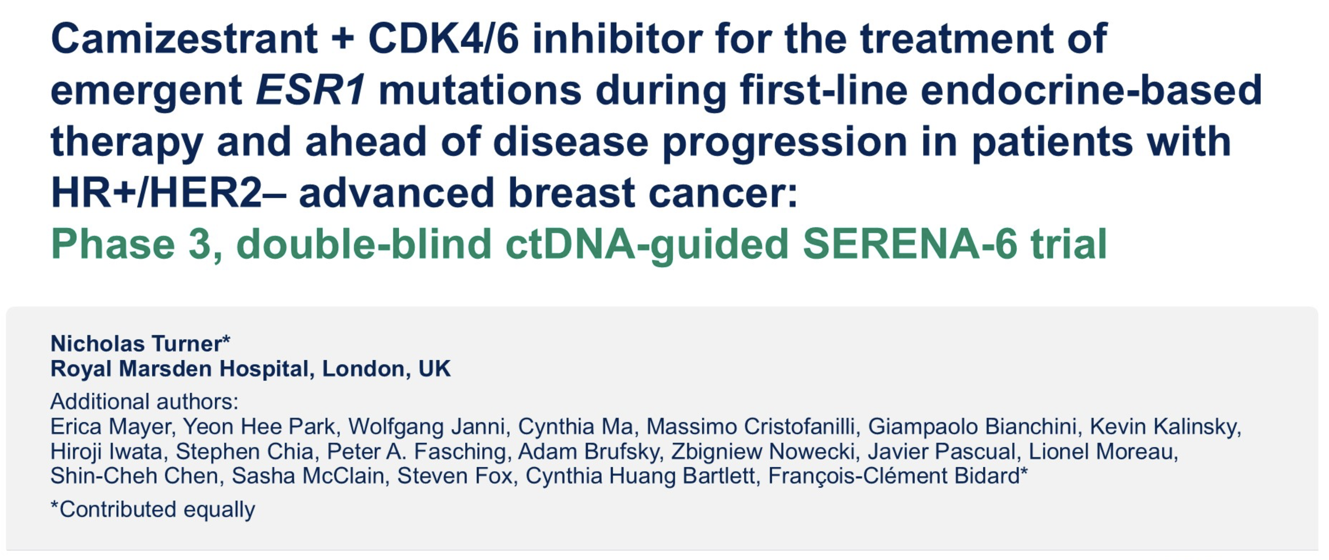
N Engl J Med June 1, 2025;[Online ahead of print].
ASCO 2025;Abstract LBA4.

Slide 77
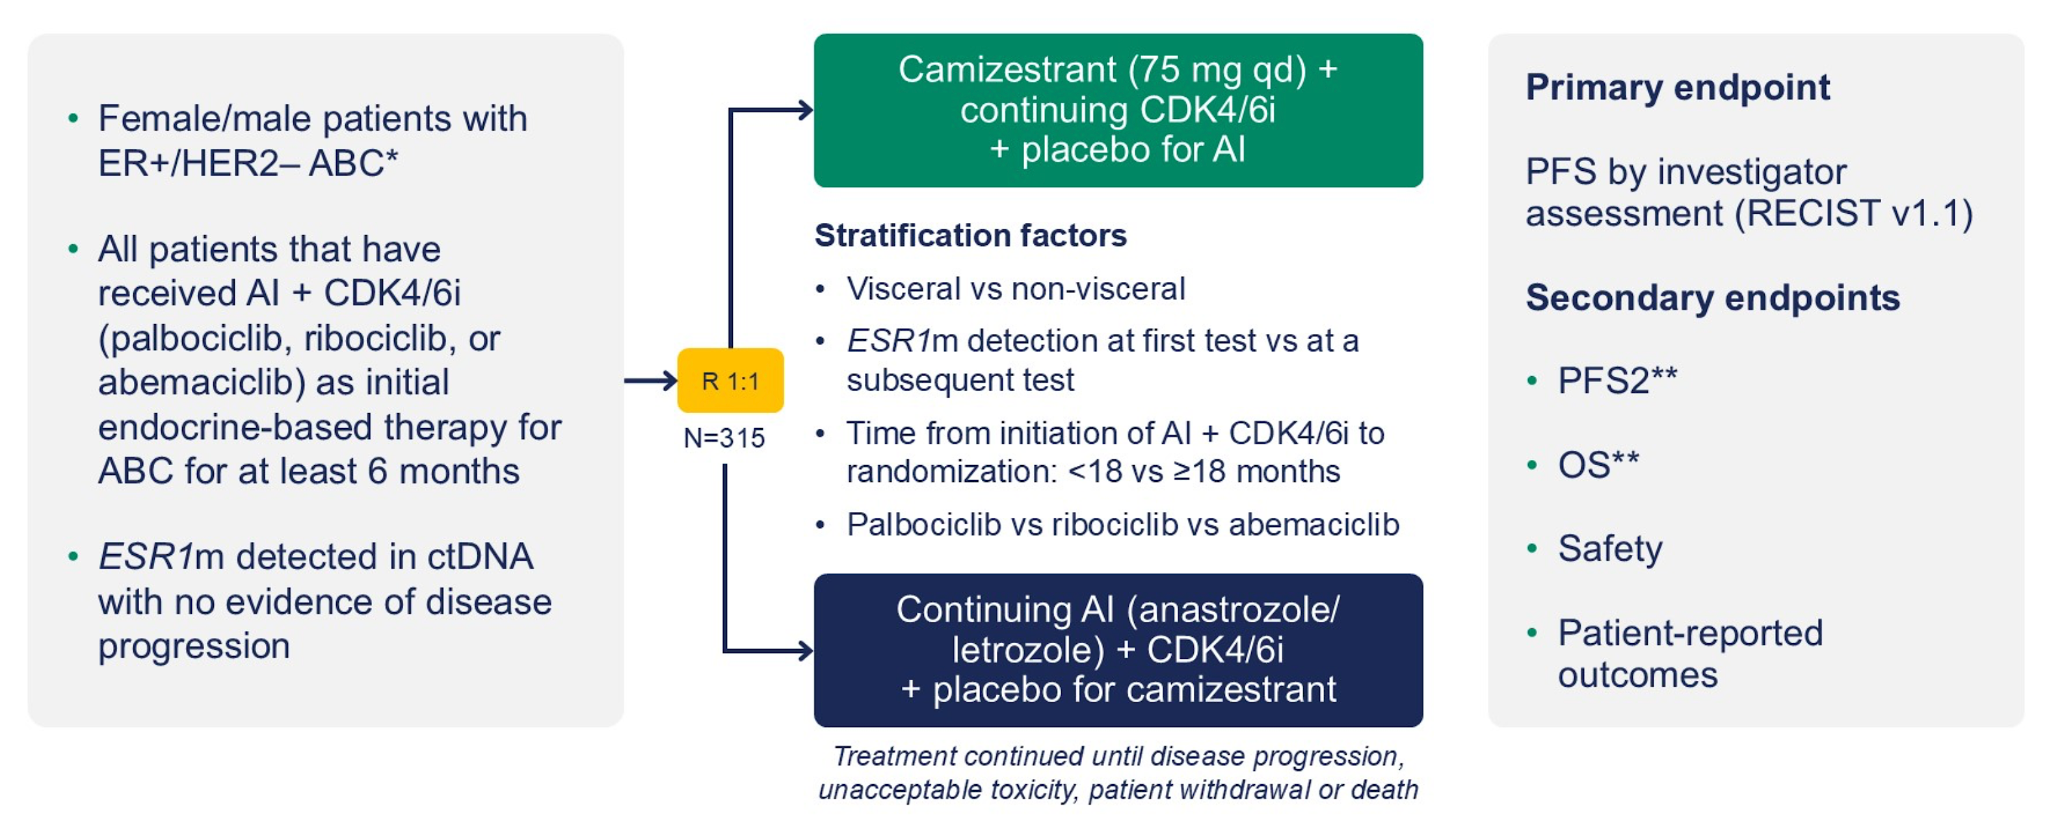
SERENA-6 Study Design
Bidard F-C et al. N Engl J Med June 1, 2025;[Online ahead of print]. Turner N et al. ASCO 2025;Abstract LBA4.

Slide 78
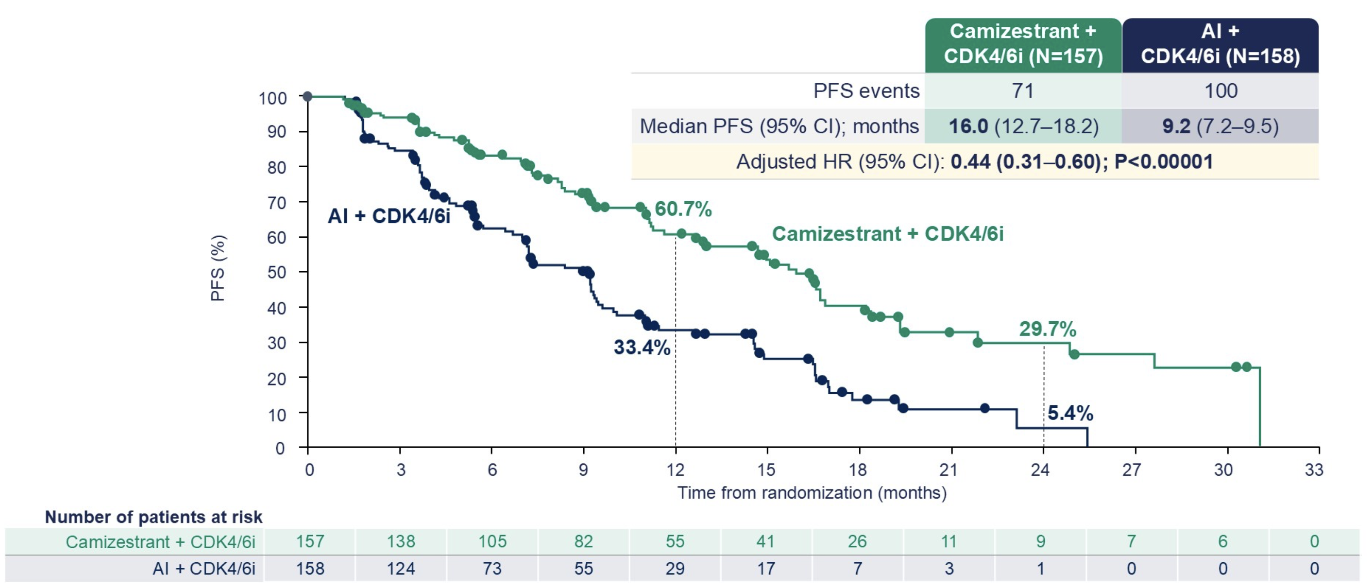
SERENA-6: PFS Outcomes
Bidard F-C et al. N Engl J Med June 1, 2025;[Online ahead of print]. Turner N et al. ASCO 2025;Abstract LBA4.

Slide 79
Key Endocrine/SERD Questions 2025
Eligibility for up-front inavolisib/palbociclib/fulvestrant
(de novo? HbA1c?)

Slide 80
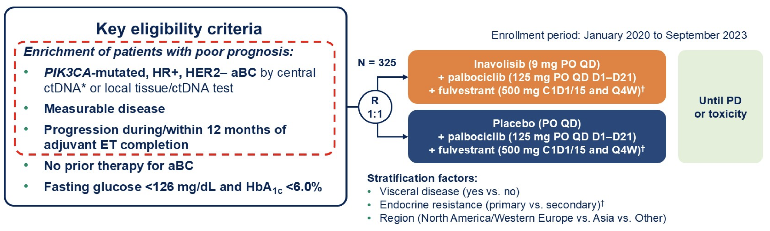
INAVO120 Study Design
ET = endocrine therapy; PD = disease progression
Turner N et al. ASCO 2025;Abstract 1003.

Slide 81
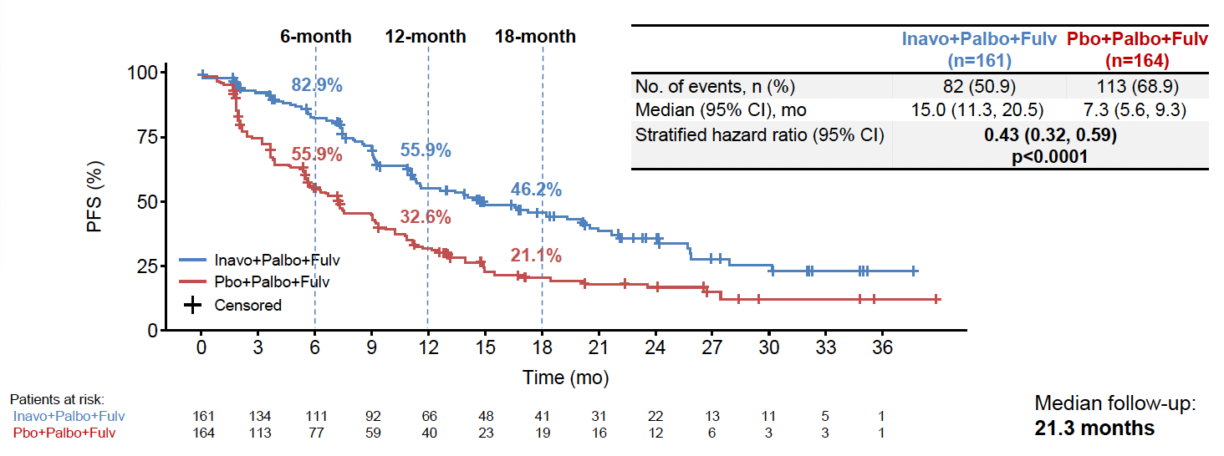
INAVO120: PFS Outcomes
Jhaveri K et al. SABCS 2023;Abstract GS03-13.

Slide 82
Key Endocrine/SERD Questions 2025
Role of CDK inhibitor after CDK inhibitor? (abemaciclib)

Slide 83
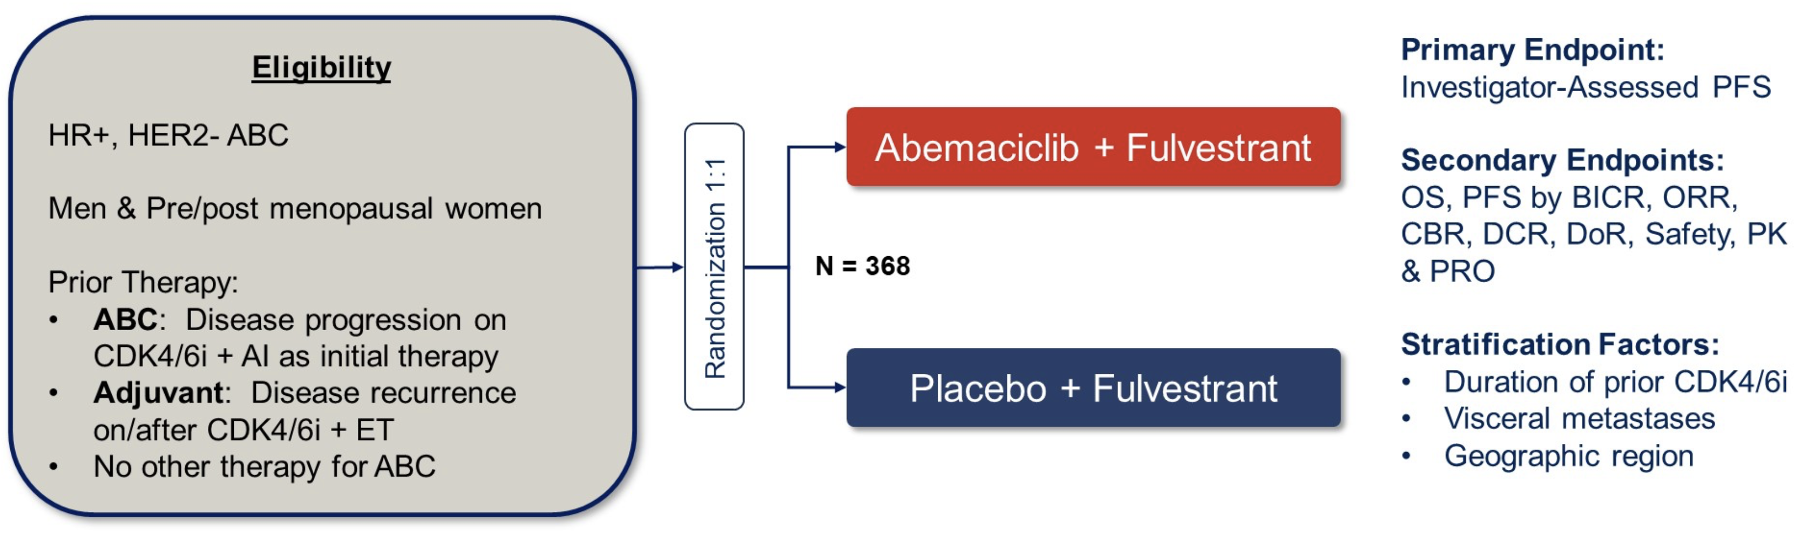
postMONARCH Study Design
ABC = advanced breast cancer; CDK4/6i = CDK4/6 inhibitor; AI = aromatase inhibitor; ET = endocrine therapy
Kalinsky K et al. ASCO 2024;Abstract LBA1001; J Clin Oncol 2025;43(9):1101-12.

Slide 84
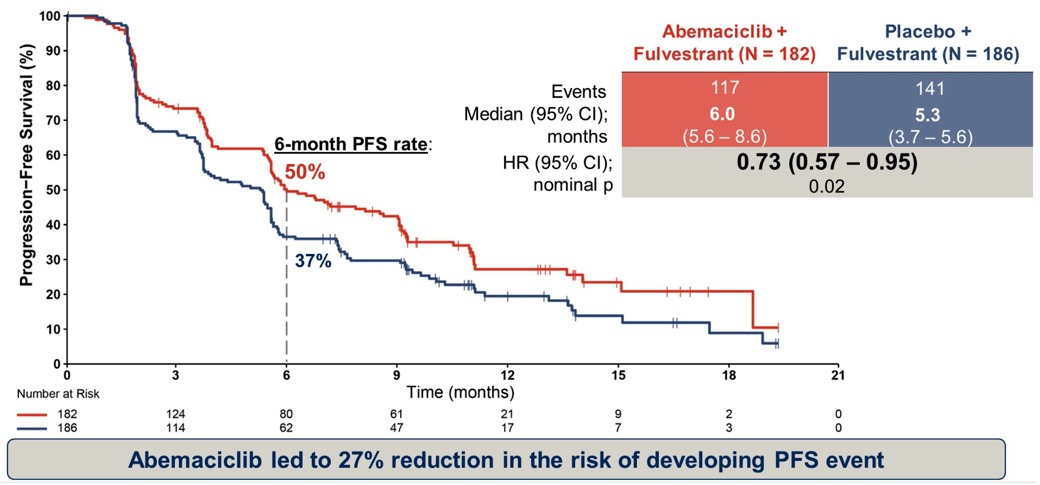
postMONARCH: Progression-Free Survival (PFS) Outcomes
Kalinsky K et al. ASCO 2024;Abstract LBA1001; J Clin Oncol 2025;43(9):1101-12.

Slide 85
Key Endocrine/SERD Questions 2025
Role of CDK inhibitor with SERD (abemaciclib/imlunestrant)

Slide 86
EMBER-3 Study Design
Jhaveri KL et al. San Antonio Breast Cancer Symposium 2024;Abstract GS1-01.

Slide 87
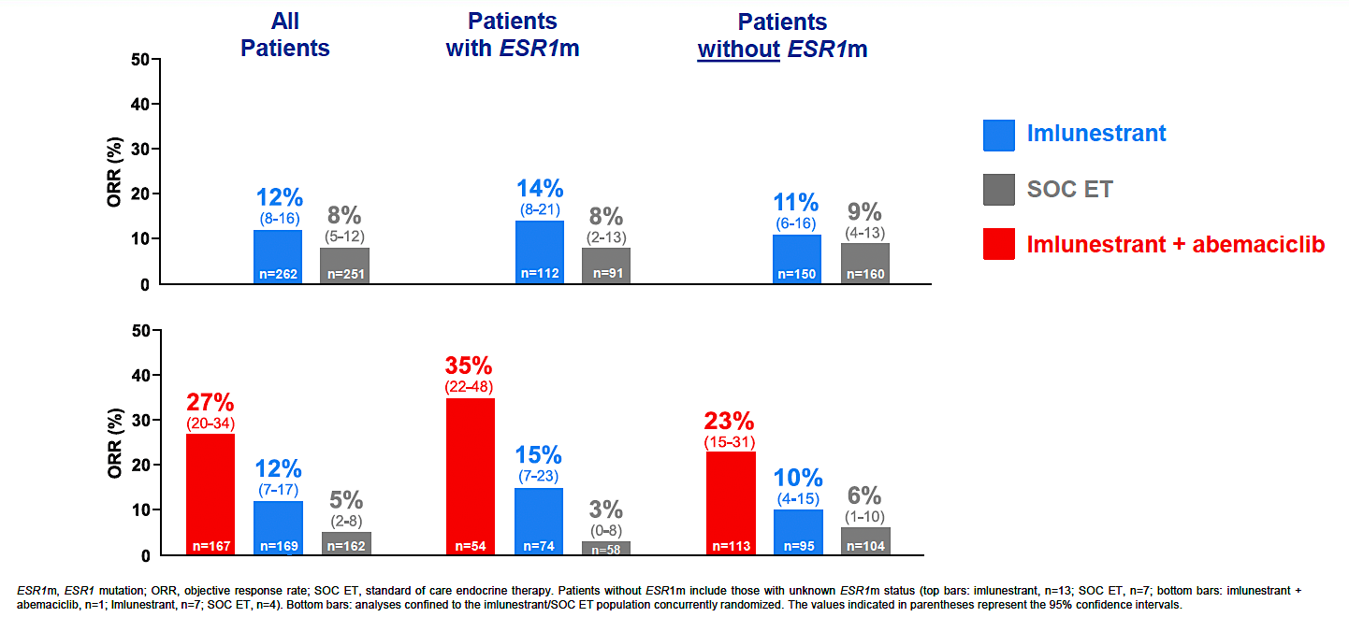
EMBER-3: Investigator-Assessed Objective Response Rate
Jhaveri KL et al. San Antonio Breast Cancer Symposium 2024;Abstract GS1-01.

Slide 88
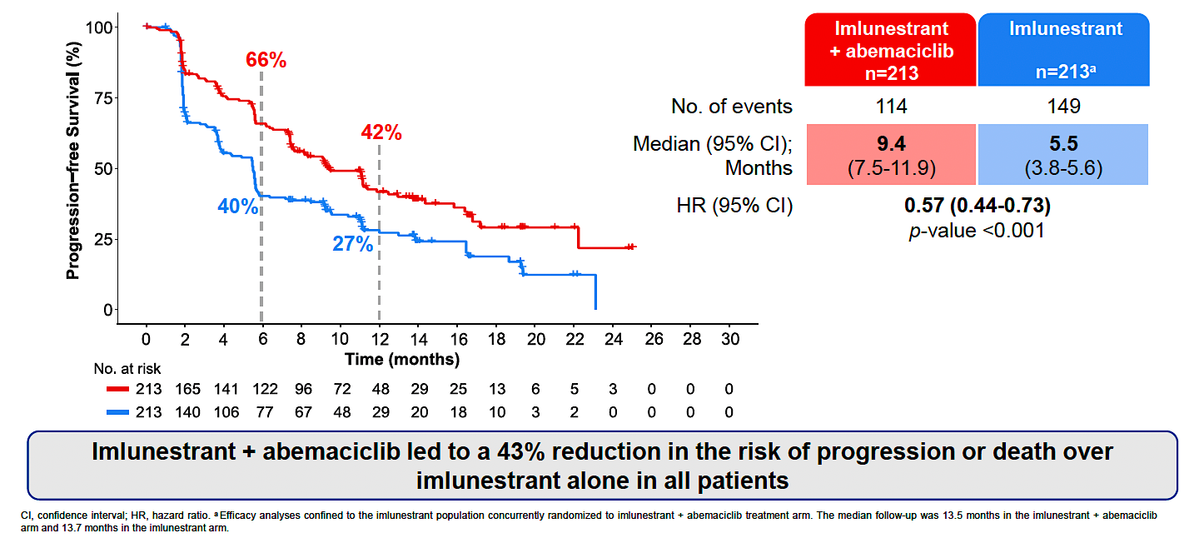
EMBER-3: PFS with Imlunestrant and Abemaciclib for All Patients
Jhaveri KL et al. San Antonio Breast Cancer Symposium 2024;Abstract GS1-01.

Slide 89
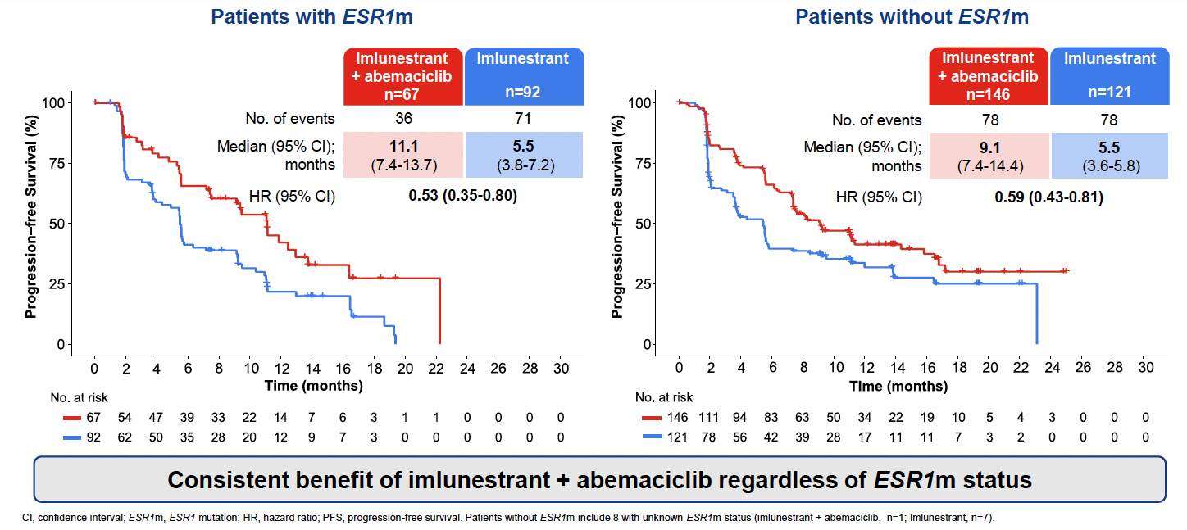
EMBER-3: PFS with Imlunestrant and Abemaciclib by ESR1m Status
Jhaveri KL et al. San Antonio Breast Cancer Symposium 2024;Abstract GS1-01.

Slide 90
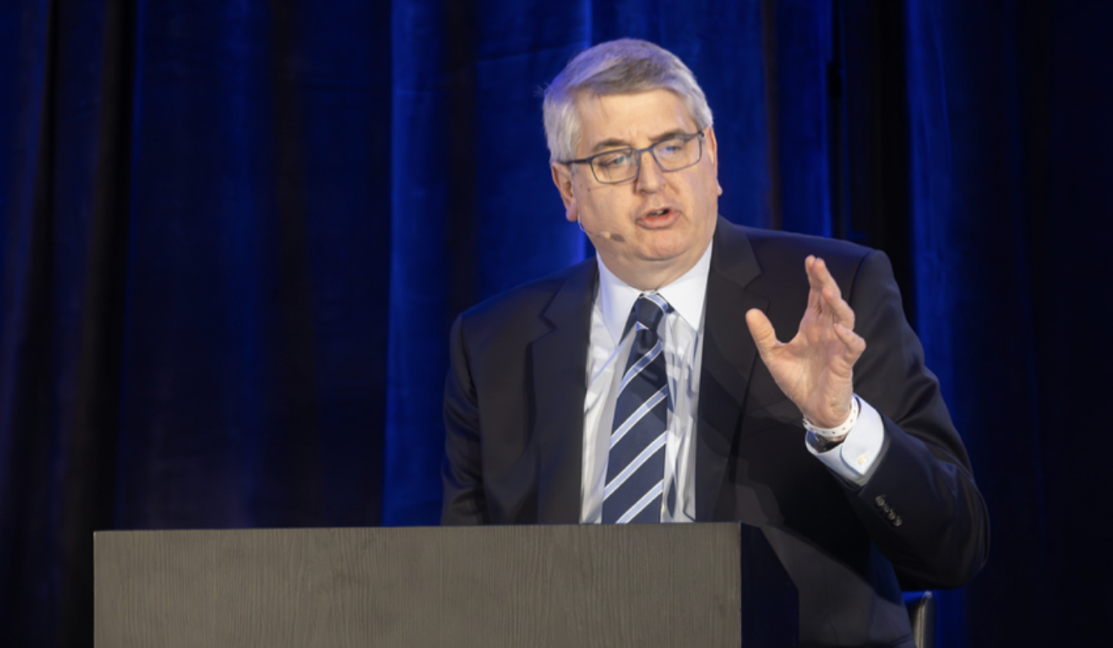
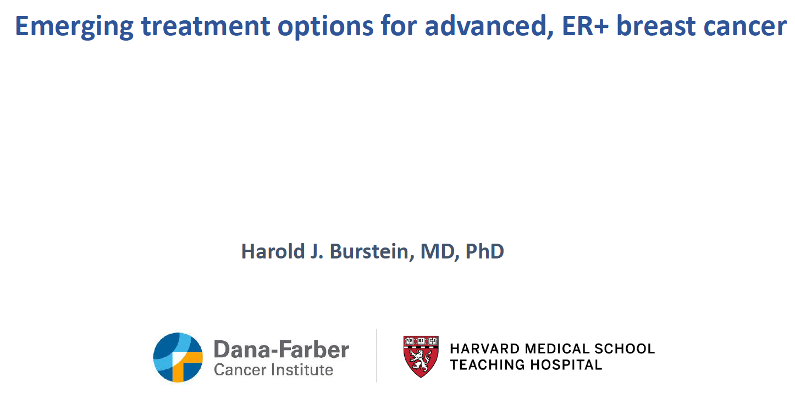
Emerging treatment options for
advanced, ER+ breast cancer
Abstract GS1-01 Discussant, SABCS 2024

Slide 91
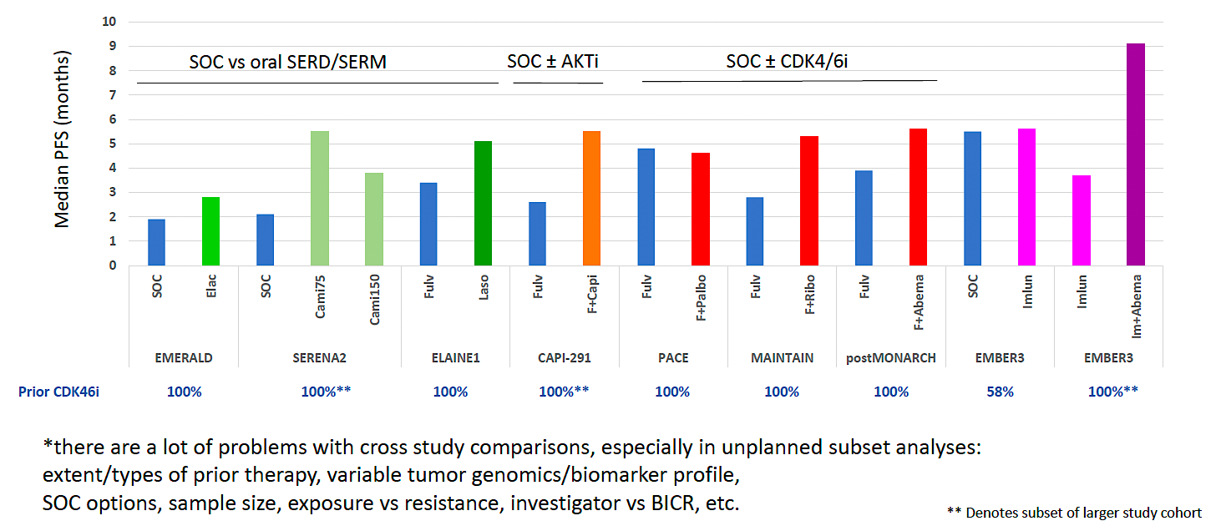
Median PFS in Recent Randomized Trials of Endocrine Therapy: Outcomes Among Patients Who Received Prior CDK4/6 Inhibitor Treatment*
PFS = progression-free survival; SOC = standard of care; BICR = blinded independent central review
Burstein H. San Antonio Breast Cancer Symposium 2024;Abstract GS1-01 Discussant.

Slide 92
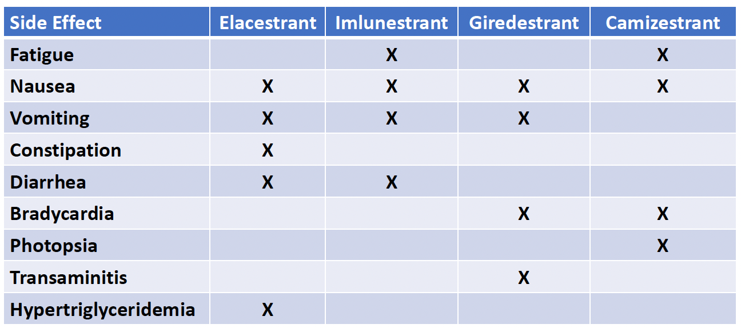
SERDs: Side Effects Encountered More Commonly Than with Fulvestrant in Randomized Clinical Trials
Burstein H. San Antonio Breast Cancer Symposium 2024;Abstract GS1-01 Discussant.

Slide 93
Key Endocrine/SERD Questions 2025
SERD after AKT inhibitor and reverse?

Slide 94
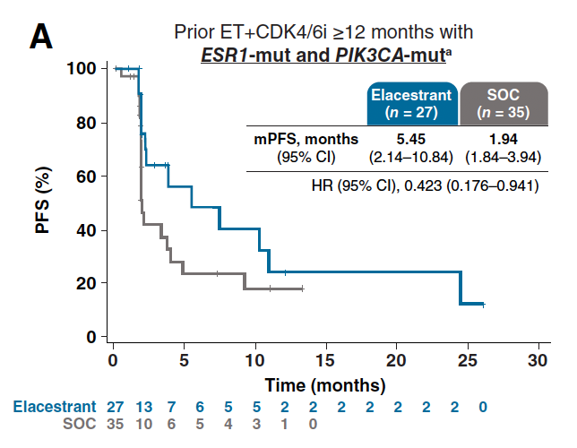
Elacestrant for Patients with PIK3CA-Mutated Disease
Bardia A et al. Clin Cancer Res 2024 August 1;[Online ahead of print].

Slide 95
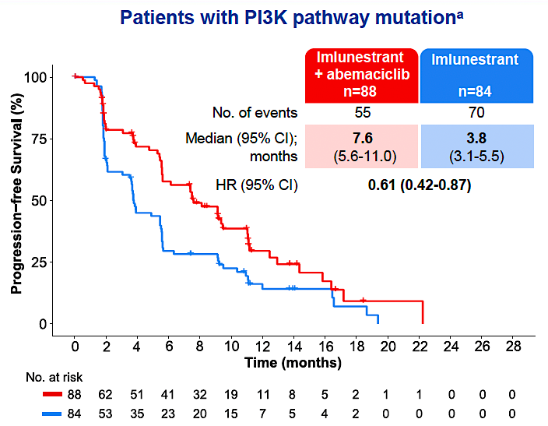
Imlunestrant and Abemaciclib in PIK3CA-Mutated Disease
Jhaveri KL et al. San Antonio Breast Cancer Symposium 2024;Abstract GS1-01.

Slide 96
Key Endocrine/SERD Questions 2025
CDK inhibitor (palbociclib) after first-line T-DXd (ESR1+, HER2+)?

Slide 97
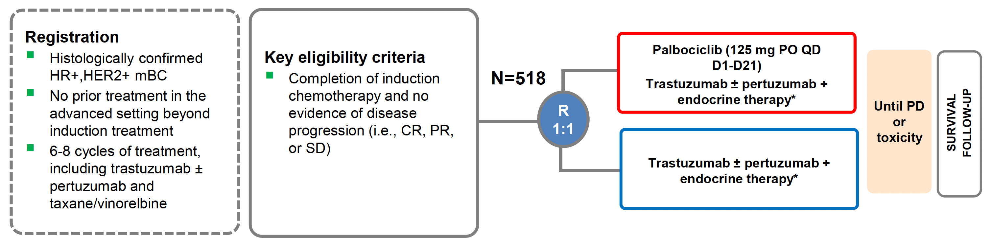
PATINA Study Design
Metzger O et al. SABCS 2024;Abstract P2-03-20.

Slide 98
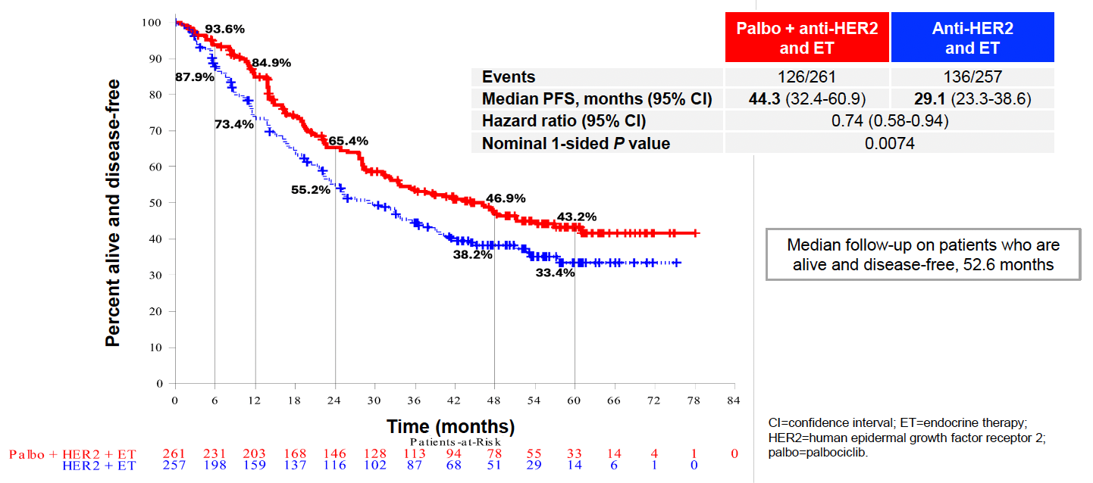
PATINA: PFS Outcomes
Metzger O et al. SABCS 2024;Abstract P2-03-20.

Slide 99
SERDs in ER-Positive, HER2-Negative
Localized Breast Cancer

Slide 100
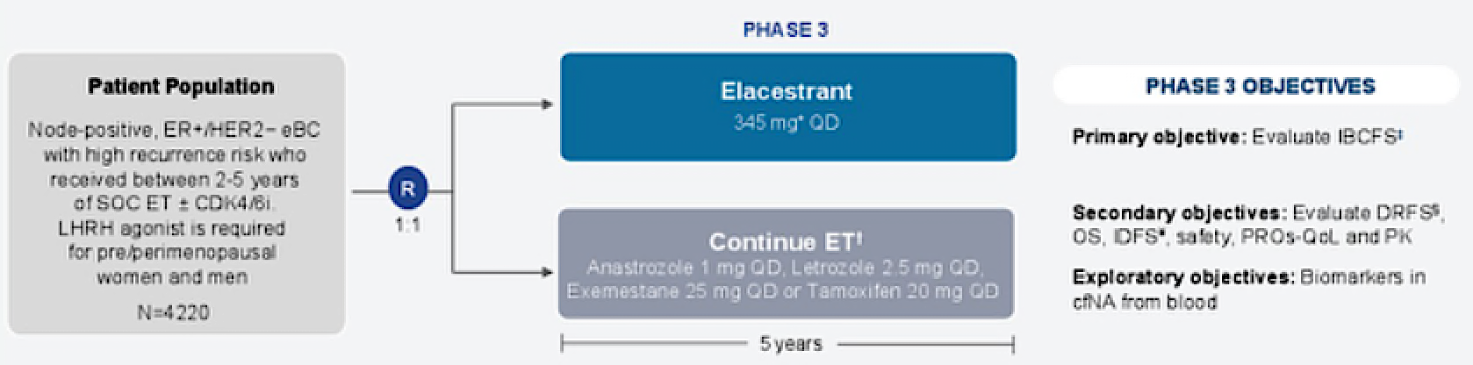
ELEGANT Study Design
IBCFS = invasive breast cancer-free survival; DRFS = distant relapse-free survival; OS = overall survival; IDFS = invasive disease-free survival; PK = pharmacokinetics; cfNA = cell-free nucleic acid
Bardia A et al. SABCS 2024;Abstract P2-08-21.

Slide 101

Clin Cancer Res 2024;[Online ahead of print].

Slide 102
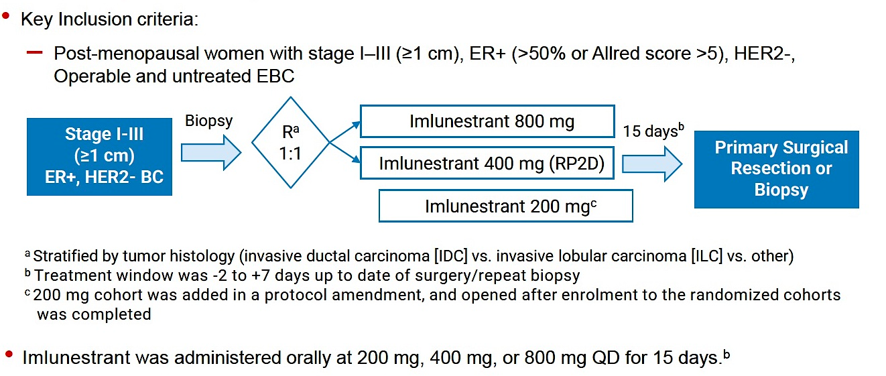
EMBER-2 Study Design
EBC = early breast cancer

Slide 103
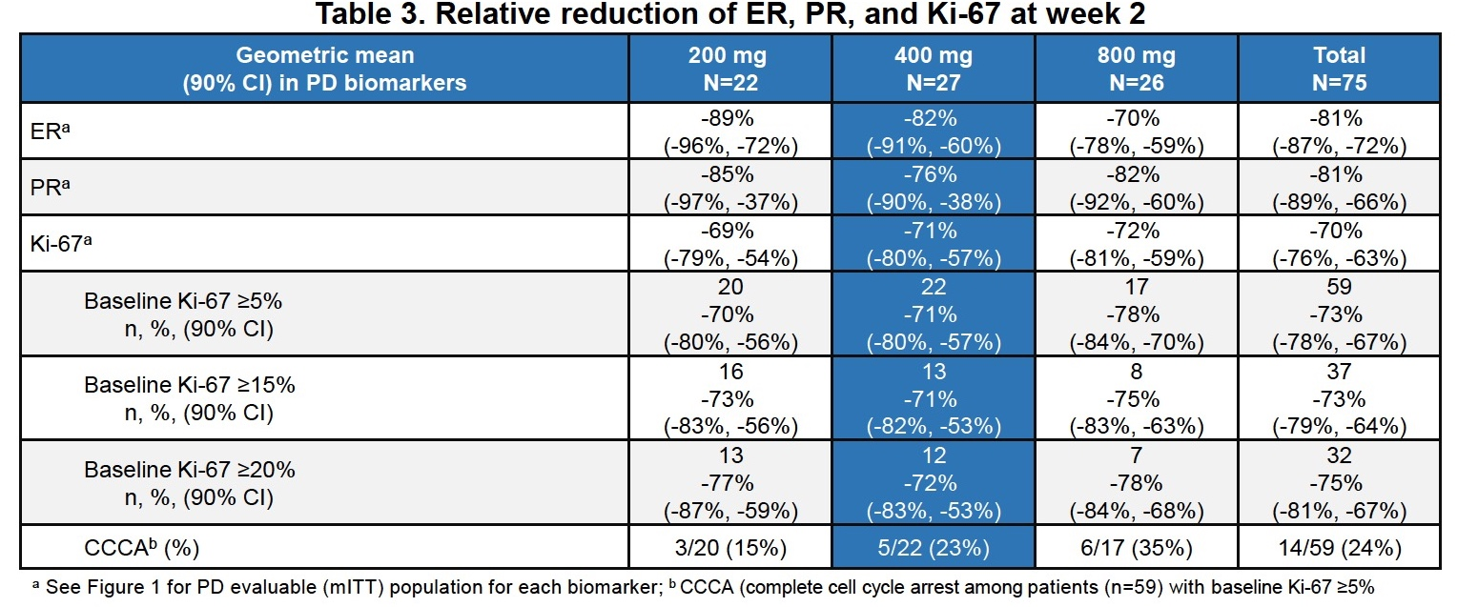
Primary Endpoint of EMBER-2: Relative Reduction of ER Expression
Recommended Phase II dose (RP2D): 400 mg QD
Neven P et al. Clin Cancer Res 2024;[Online ahead of print].

Slide 104
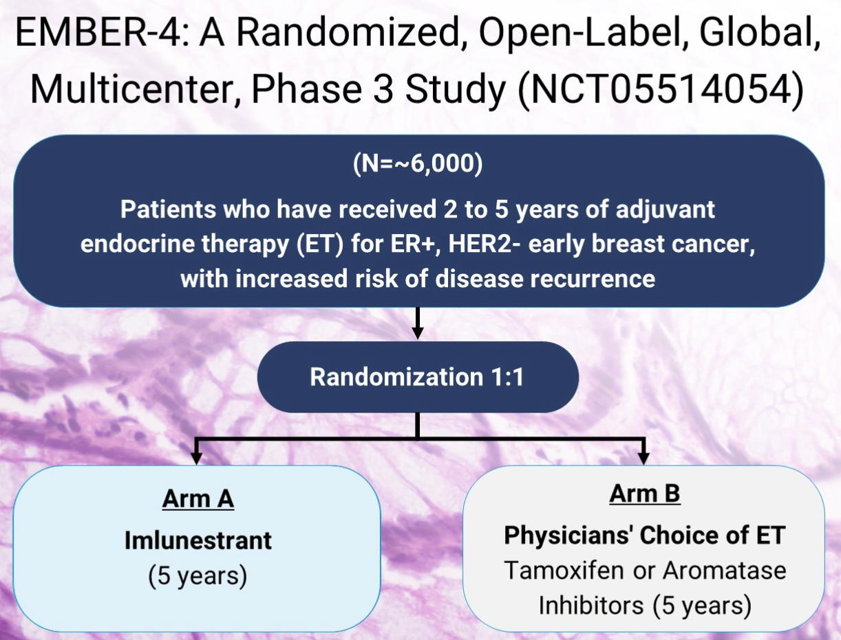
EMBER-4 Study Design
Jhaveri KL et al. San Antonio Breast Cancer Symposium 2022;Abstract OT1-01-02.

Slide 105
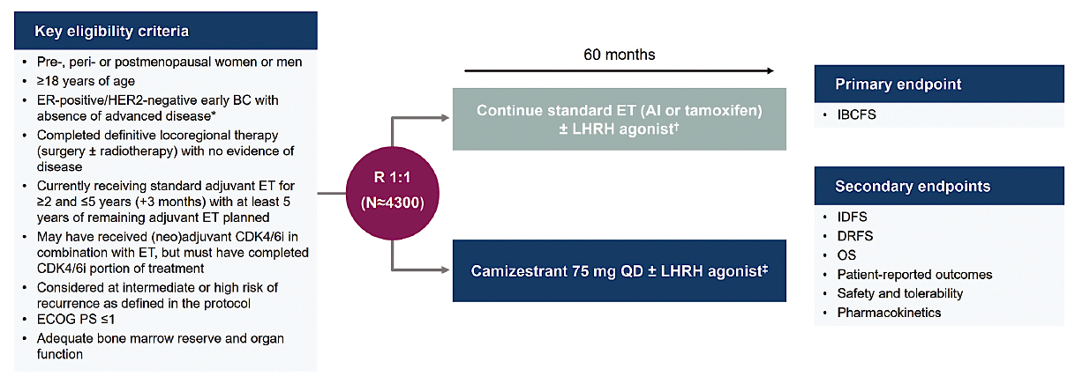
CAMBRIA-1 Study Design
IBCFS = invasive breast cancer-free survival; IDFS = invasive disease-free survival; DRFS = distant relapse-free survival; OS = overall survival
Hamilton E et al. Future Oncol 2025;21(7):795-806.

Slide 106

CAMBRIA-2 Study Design
Hamilton E et al. Future Oncol 2025;21(7):795-806.

Slide 107
persevERA Breast Cancer Study Design
Giredestrant (30 mg PO)
+ palbociclib (125 mg PO qd)
Key inclusion criteria
Previously untreated ER+, HER2− locally advanced or metastatic breast cancer
Relapse during tamoxifen therapy but >24 months after the start of tamoxifen therapy is allowed
R
1:1
(N = 978)
Letrozole (2.5 mg PO)
+ palbociclib (125 mg PO qd)
Turner NC et al. ASCO 2021;Abstract TPS1103.

Slide 108
Questions from General Medical Oncologists
What is your opinion on the future role of oral SERDs in earlier-stage breast cancer settings (eg, adjuvant or neoadjuvant use)?
What strategies can I use to enhance adherence in patients on oral SERDs, especially in those with financial, cognitive, or logistical barriers?
I got burned by using alpelisib due to it was causing DKA in my patient, with other -lisibs now, is there any reason for trying to give alpelisib again?
Re PATINA trial, would you add palbociclib to the HP/AI regimen if a patient has been stable for years?

Slide 109
Agenda
Introduction: ER-Positive Metastatic Breast Cancer — Bringing Research Data into Practice
Module 1: Key Issues from GMO Survey
Module 2: Faculty Cases and GMO Questions

Slide 110
Dr Kaklamani – Case Presentation
A 42-year-old premenopausal woman was diagnosed with invasive ductal carcinoma (IDC) of the left breast.
ER: 80%; PR: 60%; HER2: 1+.
She underwent breast-conserving surgery and was found
to have a 2.5-cm IDC, grade 2, with 1+ axillary lymph nodes.
She was given adjuvant chemotherapy with ACT (doxorubicin, cyclophosphamide, paclitaxel) and then was put on ovarian function suppression (OFS) and anastrozole for 5 years.

Slide 111
Dr Kaklamani – Case Presentation (cont’d)
At 15 mo after discontinuing adjuvant endocrine therapy, she was found to have bone metastases.
Biopsy showed IDC, with ER: 60%; PR: 60%; HER2: 1+.
She was started on OFS with letrozole and ribociclib.
After 26 months of therapy, she was found to have progression of disease with liver metastases.
A liquid biopsy showed an ESR1 mutation and no other actionable mutations.
She was put on elacestrant and continued on it for 12 mo until progression.
During treatment she complained of nausea grade 1 and was given ondansetron which she took PRN.

Slide 112
Dr Jhaveri – Case Presentation
57 year old postmenopausal woman presented with de novo ER+/HER2 – (IHC 1+) metastatic breast cancer to the bones (biopsy proven) in late 2019.
She was started on Letrozole plus Palbociclib and after nearly 5 years progressed in the bones with 1 new liver metastases. LFTs were normal and she is asymptomatic. Guardant360® panel showed ESR1D538G mutation. Genetics testing was negative.
What is the next best treatment option?
  Trastuzumab Deruxtecan
  Capecitabine
  Everolimus + Fulvestrant
  Fulvestrant
  Elacestrant

Slide 113
Dr Jhaveri – Case Presentation continued
She started on Elacestrant in October of 2024 and recent imaging in June 2025 showed stable disease. Tolerating elacestrant very well with some intermittent grade 1 nausea and fatigue

Slide 114
Questions from General Medical Oncologists
Optimal assay for ESR1 mutation?
Tissue versus liquid genomic analysis?
How often should liquid biopsies be done in the management of mBC?
Should SERDs be considered in hormone-low tumors? What about
triple-positive cases?
Data for SERD in non-ESR patient?

Slide 115
Questions from General Medical Oncologists
What advantages do oral SERDs offer over intramuscular fulvestrant?
How do oral SERDs like elacestrant, imlunestrant, camizestrant, and giredestrant differ in their estrogen receptor degradation potency and selectivity?
Which oral SERD is best tolerated and used in combination with other agents?
What strategies should be used to mitigate/prevent nausea and vomiting that I have seen with my patients starting elacestrant?
Unique side effects of oral SERDs and management strategies?

Slide 116
Dr Jhaveri – Case Presentation
53 year old postmenopausal woman presented with Stage 2 breast cancer. She is s/p lumpectomy and SLND and tumor size was 4.2 cm, grade 2, 0/3 LN ER80% PR 40% HER2 – (IHC 1+) and Oncotype RS of 27. She completed TC chemotherapy and adjuvant radiation and started letrozole. After 1 year of completing letrozole she developed back pain and workup led to a diagnosis of metastatic breast cancer to the bones and liver (biopsy proven; 3 lesions, largest 2.3 cm X 2.1 cm) ) in June 2021. Liver biopsy confirmed ER 65% PR 30% and HER 2 (IHC 1+). Tissue NGS showed no actionable alterations. PMH significant for hypothyroidism controlled on levothyroxine.
She was started on anastrazole plus palbociclib and tolerated it well without any need for dose modifications. In July of 2023, she was diagnosed with metastatic disease to the liver and bones (multiple mets in spine and ribs). Guardant360 panel was done and showed ESR1Y537S and ESR1 380Q mutation. Genetics testing was negative.
What is the next best treatment option?
  Fulvestrant plus ribociclib
  Fulvestrant + Abemaciclib
  Capecitabine
  Everolimus + Fulvestrant
  Fulvestrant
  Elacestrant
  EMBER-3 trial

Slide 117
Dr Jhaveri – Case Presentation continued
She was enrolled to EMBER-3 clinical trial and was randomized to Arm C- Imlunestrant + Abemaciclib
She developed grade 1 diarrhea and fatigue but didn’t require dose reductions. Diarrhea was managed with Imodium and dietary modifications
Remained on trial until July 2024; came off for progression in the bones and liver
No new alterations seen on Guardant
Started on capecitabine with progression in liver in Dec 2024
Remains on Trastuzumab deruxtecan. Has some fatigue but tolerating it well with responding disease

Slide 118
Dr Kaklamani – Case Presentation
  A 56-year-old postmenopausal woman was diagnosed with IDC of the right breast.
  ER: 100%; PR: 80%; HER2: 2+ FISH-.
  She underwent breast-conserving surgery and was found
  to have 3.2-cm IDC, grade 3, without any axillary lymph node involvement.
  She had a 21-gene Recurrence Score® of 27 and was given
  adjuvant chemotherapy with docetaxel and cyclophosphamide (TC) x 4 and then was put on anastrozole.

Slide 119
Dr Kaklamani – Case Presentation (cont’d)
  At 4 years after initiation of adjuvant therapy, she was found to have bone and lung metastases.
  A biopsy showed IDC, with ER: 80%; PR: 40%; HER2: 1+.
  She was started on fulvestrant and palbociclib.
  After 18 months of therapy, she was found to have progression of disease with liver metastases.
  A liquid biopsy showed an ESR1 mutation and no other actionable mutations.
  She enrolled on the EMBER-3 clinical trial and was randomly assigned to imlunestrant and abemaciclib
  During therapy she developed grade 2 diarrhea which required treatment with loperamide but no dose reduction.
  She continued on therapy for 15 months until disease progression.

Slide 120
Questions from General Medical Oncologists
Sequencing strategy if both ESR1 mutation and AKT1/PIK3CA/PTEN mutation are present?
Why is imlunestrant still not available when the NEJM article was out in
Dec 2024 showing impressive activity in combination with abemaciclib?
Any situations where you would use imlunestrant/abemaciclib in first line treatment?
Does it matter what the first CDK4/6i was in considering imlunestrant/
abemaciclib second line?
Male breast cancer patient treatment?

Slide 121
Questions from General Medical Oncologists
SERDs with visceral crisis or high disease burden? Do you feel comfortable initiating endocrine therapy?
Can you share a case where oral SERD therapy significantly altered the course of a patient’s treatment plan or prognosis?
How to pick between the PIK3CA/AKT meds?
How to monitor the development of resistance to oral SERDs?

Slide 122
Questions from General Medical Oncologists
How often to watch A1c and lipids on PIK3CA drugs?
Based on recent ASCO presentation is vepdegestrant still being deemed HOPEFUL to replace oral SERD?
PROTAC may not be as effective as imlunestrant, am I wrong here?
This may be a shot in the dark but a single drug that would combine both SERM and SERD activity?

Slide 123
Dr Kaklamani – Case Presentation
  A 65-year-old postmenopausal woman was diagnosed with IDC of the right breast.
  ER: 80%; PR: 80%; HER2: 1+.
  At the time of diagnosis, she complained of lower back pain.
  Imaging revealed a lesion in her lumbar spine.
  She had a biopsy showing IDC, with ER: 60%; PR: 20%; HER2: 2+ consistent with her primary disease.

Slide 124
Dr Kaklamani – Case Presentation (cont’d)
  The patient was started on the nonsteroidal aromatase inhibitor letrozole and the CDK4/6 inhibitor abemaciclib.
  After 6 months of therapy, she enrolled on SERENA-6 and started having serial ctDNA testing.
  After an additional 9 months her ctDNA revealed an ESR1 mutation. At the time her staging scans showed stable disease.
  She was randomly assigned to switch to camizestrant and continue abemaciclib.
  During therapy she developed photopsia grade 1 which did not require any dose reductions and continued on therapy for 15 months until radiologic disease progression.

Slide 125
Dr Jhaveri – Case Presentation
62 years old was diagnosed with stage IIA breast cancer s/p lumpectomy that revealed a 2.1 cm grade 2 node-negative tumor, ER 90% PR 90% and HER2 IHC 0, Oncotype DX® RS 15, completed radiation and 5 years of adjuvant letrozole in 2021.
In late summer of 2022 was diagnosed with metastatic disease to the bones, biopsy proven, ER/PR 80% HER2 IHC 1+. She started treatment with anastrozole with ribociclib in September of 2022 and tolerated it well without any need for dose modifications.
After 8 months while on 1L therapy, she was enrolled to the SERENA-6 trial and started serial ctDNA monitoring. In April of ‘25, ESR1 mutation was detected. She remains asymptomatic and is continuing on the therapeutic portion of the trial.

Slide 126
Questions from General Medical Oncologists
Use of SERENA-6?
Re the SERENA-6 trial, how do we know that overall survival will be longer with this approach rather than just waiting to switch to camizestrant when there is actual progression? Did the trial go over that or are we waiting for PFS2 data?
Any CNS activity with SERDs?
Beyond ESR1 mutation status, what patient-specific clinical factors (eg, prior CDK4/6i duration, visceral crisis, burden of disease) should guide the choice between an oral SERD or an ADC/chemotherapy in the post-CDK4/6i setting?

Slide 127
Questions from General Medical Oncologists
How do you choose between the ADCs that attack TROP2?
Should you go from ADC to ADC or something in between?
T-DXd and Dato-DXd sequencing
Sequencing in HR+, HER2 low metastatic disease
When to use T-DXd in HR+/HER2 ultralow
How much pulmonary toxicity are investigators seeing in the real world with T-DXd?

Slide 128
Practical Perspectives: Experts Review
Actual Cases of Patients with Biliary Tract Cancers
A CME/MOC-Accredited Live Webinar
Wednesday, August 6, 2025
5:00 PM – 6:00 PM ET
Faculty
Haley Ellis, MD
James J Harding, MD
Moderator
Neil Love, MD

Slide 129
Thank you for joining us!
Please take a moment to complete the survey currently up on Zoom. Your feedback is very important to us.
The survey will remain open for
5 minutes after the meeting ends.
Information on how to obtain CME, ABIM MOC and ABS credit is provided in the Zoom chat room.
Attendees will also receive an email in 1 to 3 business days with these instructions.

