Slide 1
The Implications of Recent Datasets for the Current and Future Management of Non-Hodgkin Lymphoma
A CME/MOC-Accredited Live Webinar
Wednesday, September 17, 2025 5:00 PM – 6:00 PM ET
Faculty
Carla Casulo, MD
Brad S Kahl, MD
Moderator
Neil Love, MD

Slide 2
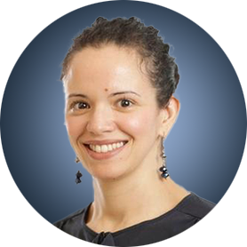
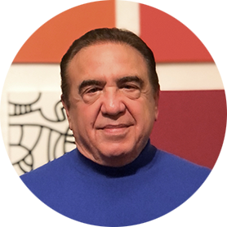

Faculty
Carla Casulo, MD
Associate Professor of Medicine
Division of Hematology/Oncology
Assistant Director, Cancer Research Training and Education
University of Rochester
Wilmot Cancer Institute
Rochester, New York
MODERATOR
Neil Love, MD Research To Practice Miami, Florida
Brad S Kahl, MD
Professor of Medicine
Washington University School of Medicine
Director, Lymphoma Program
Siteman Cancer Center
St Louis, Missouri

Slide 3
Commercial Support
This activity is supported by educational grants from ADC Therapeutics and AstraZeneca Pharmaceuticals LP.

Slide 4
Dr Love — Disclosures
Dr Love is president and CEO of Research To Practice. Research To Practice receives funds in the form of educational grants to develop CME activities from the following companies: Aadi Bioscience, AbbVie Inc, ADC Therapeutics, Alexion Pharmaceuticals, Amgen Inc, Array BioPharma Inc, a subsidiary of Pfizer Inc, Arvinas, Astellas, AstraZeneca Pharmaceuticals LP, Aveo Pharmaceuticals, Bayer HealthCare Pharmaceuticals, BeOne, Black Diamond Therapeutics Inc, Blueprint Medicines, Boehringer Ingelheim Pharmaceuticals Inc, Bristol Myers Squibb, Clovis Oncology, Coherus BioSciences, CTI BioPharma, a Sobi Company, Daiichi Sankyo Inc, Eisai Inc, Elevation Oncology Inc, Exact Sciences Corporation, Exelixis Inc, Genentech, a member of the Roche Group, Genmab US Inc, Geron Corporation, Gilead Sciences Inc, GSK, Helsinn Therapeutics (US) Inc, Hologic Inc, ImmunoGen Inc, Incyte Corporation, Ipsen Biopharmaceuticals Inc, Jazz Pharmaceuticals Inc, Johnson & Johnson, Karyopharm Therapeutics, Kite, A Gilead Company, Kura Oncology, Legend Biotech, Lilly, MEI Pharma Inc, Merck, Mersana Therapeutics Inc, Mirati Therapeutics Inc, Mural Oncology Inc, Natera Inc, Novartis, Novartis Pharmaceuticals Corporation on behalf of Advanced Accelerator Applications, Novocure Inc, Nuvalent, Pfizer Inc, Pharmacyclics LLC, an AbbVie Company, Puma Biotechnology Inc, Regeneron Pharmaceuticals Inc, Rigel Pharmaceuticals Inc, R-Pharm US, Sanofi, Seagen Inc, Servier Pharmaceuticals LLC, SpringWorks Therapeutics Inc, Stemline Therapeutics Inc, Sumitomo Pharma America, Syndax Pharmaceuticals, Taiho Oncology Inc, Takeda Pharmaceuticals USA Inc, TerSera Therapeutics LLC, and Tesaro, A GSK Company.

Slide 5
Research To Practice CME Planning Committee Members, Staff and Reviewers
Planners, scientific staff and independent reviewers for Research To Practice have no relevant conflicts of interest to disclose.

Slide 6
Dr Casulo — Disclosures
Consulting Agreements | AbbVie Inc, Genentech, a member of the Roche Group, Genmab US Inc, Incyte Corporation, Roche Laboratories Inc
Contracted Research | Genentech, a member of the Roche Group, Genmab US Inc, Gilead Sciences Inc
Honoraria | AbbVie Inc, Genentech, a member of the Roche Group, Incyte Corporation, Roche Laboratories Inc

Slide 7
Dr Kahl — Disclosures
Advisory Committees | AbbVie Inc, AstraZeneca Pharmaceuticals LP, BeOne, Bristol Myers Squibb, Genentech, a member of the Roche Group, GSK, Incyte Corporation, Lilly, Merck, Pfizer Inc, Roche Laboratories Inc
Contracted Research | BeOne, Roche Laboratories Inc
Data and Safety Monitoring Boards/Committees | BeOne, Bristol Myers Squibb, Roche Laboratories Inc

Slide 8
This educational activity contains discussion of non-FDA-approved uses of agents and regimens. Please refer to official prescribing information for each product for approved indications.

Slide 9
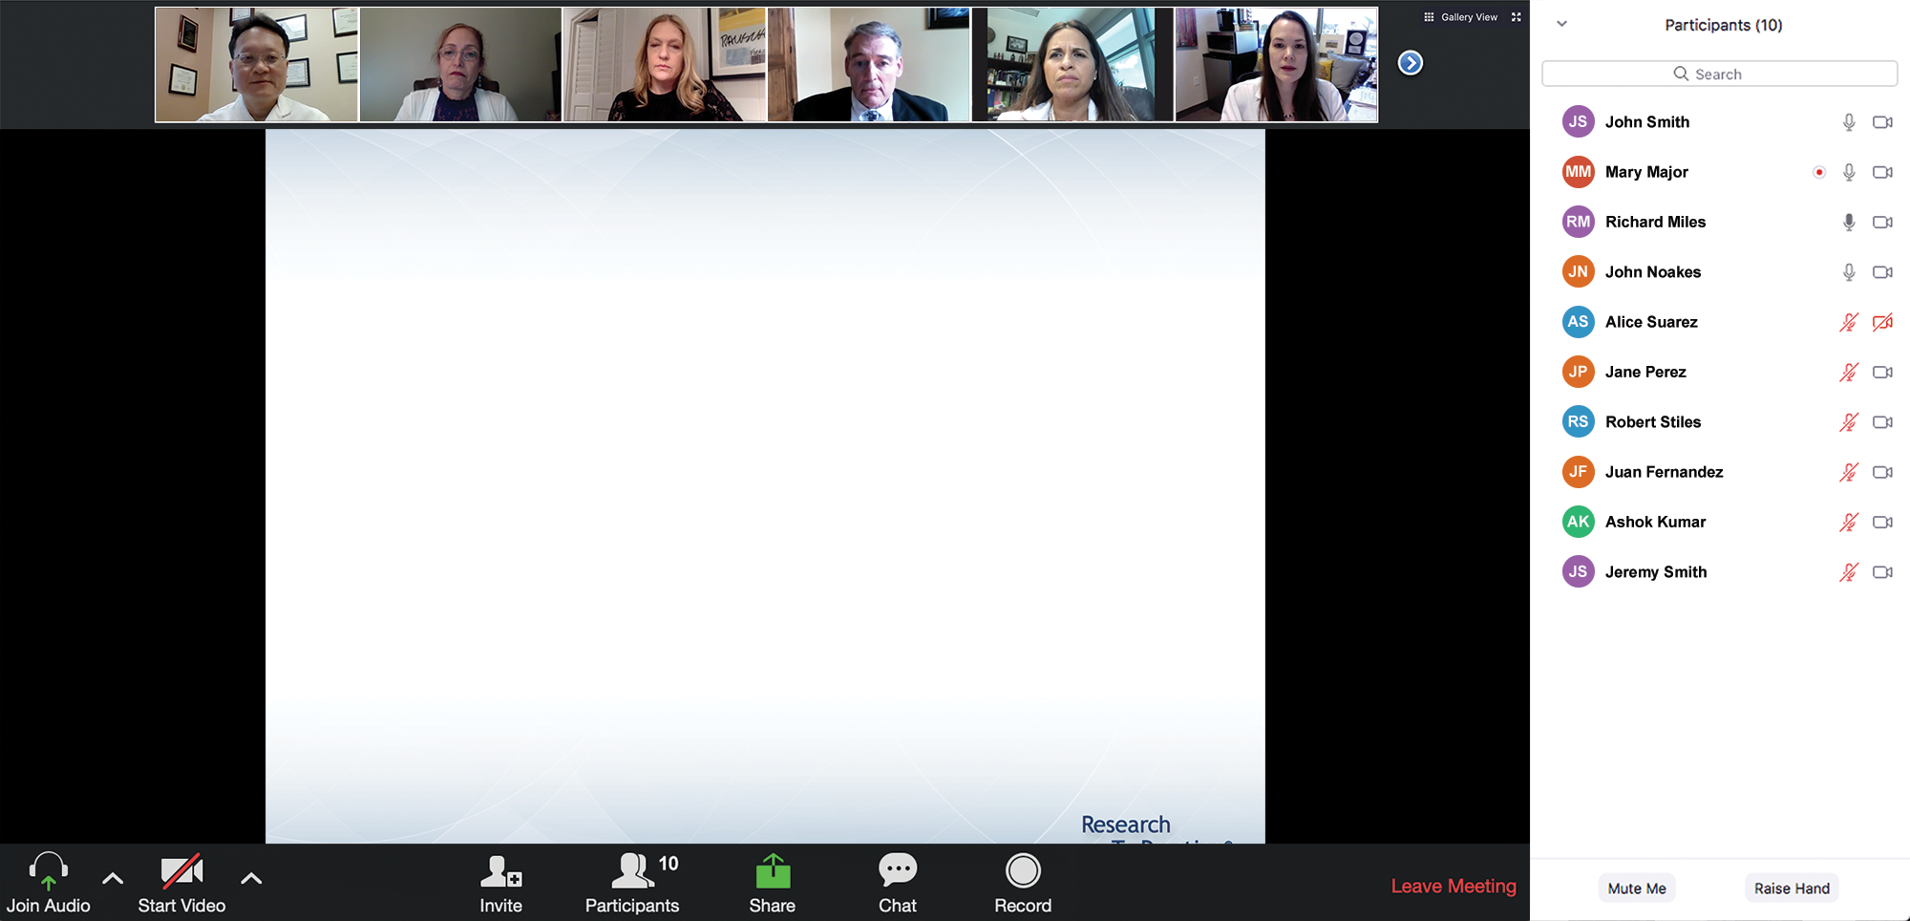
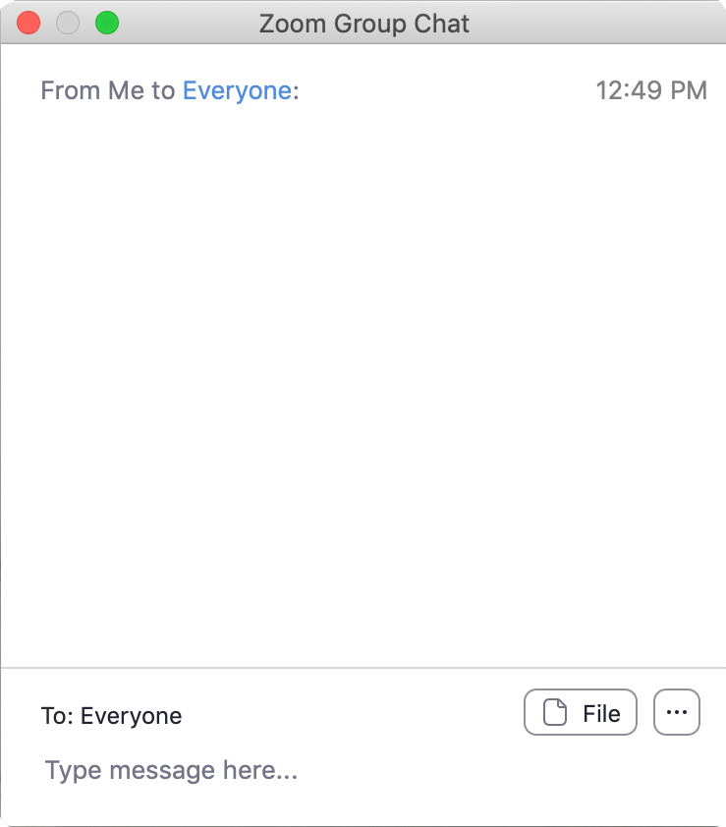
We Encourage Clinicians in Practice to Submit Questions
Feel free to submit questions now before the program begins and throughout the program.

Slide 10
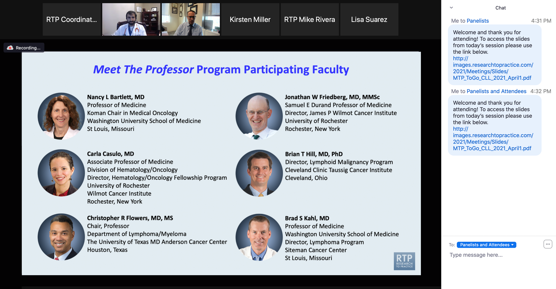
Familiarizing Yourself with the Zoom Interface
Expand chat submission box
Drag the white line above the submission box up to create more space for your message.

Slide 11
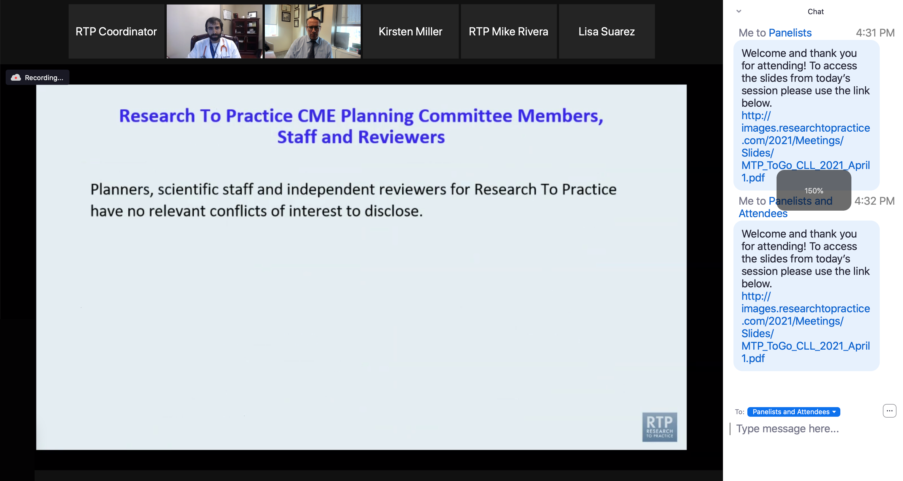
Familiarizing Yourself with the Zoom Interface
Increase chat font size
Press Command (for Mac) or Control (for PC) and the + symbol. You may do this as many times as you need for readability.

Slide 12
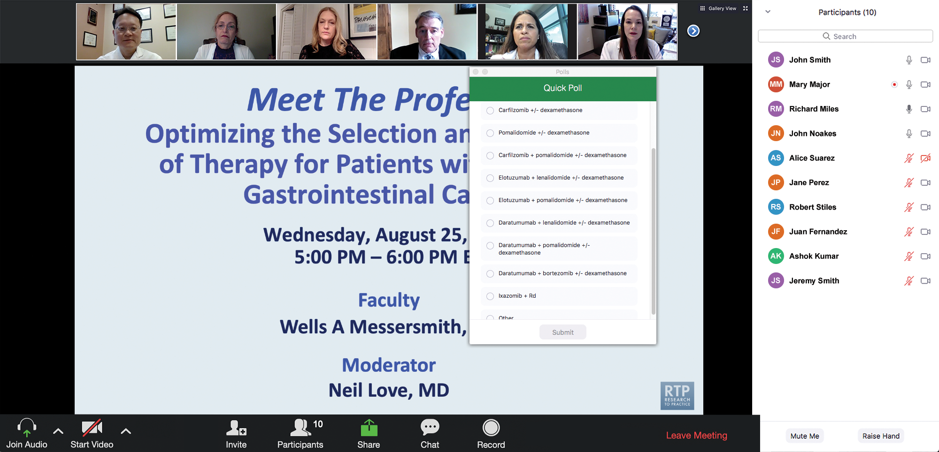
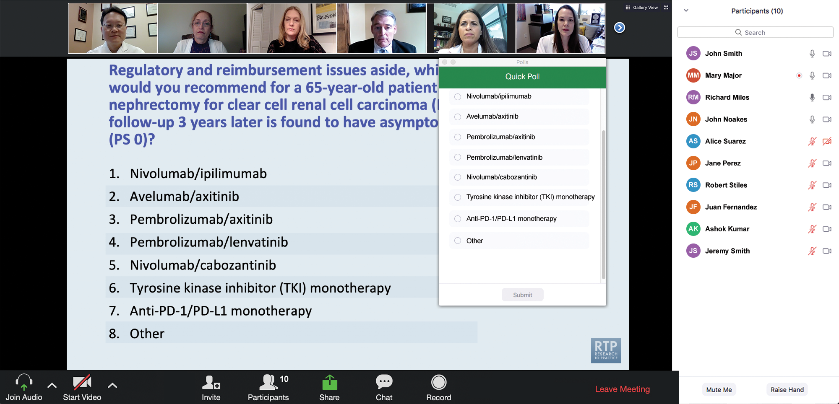
Clinicians in the Audience, Please Complete the Pre- and Postmeeting Surveys
Quick Survey
Quick Poll

Slide 13
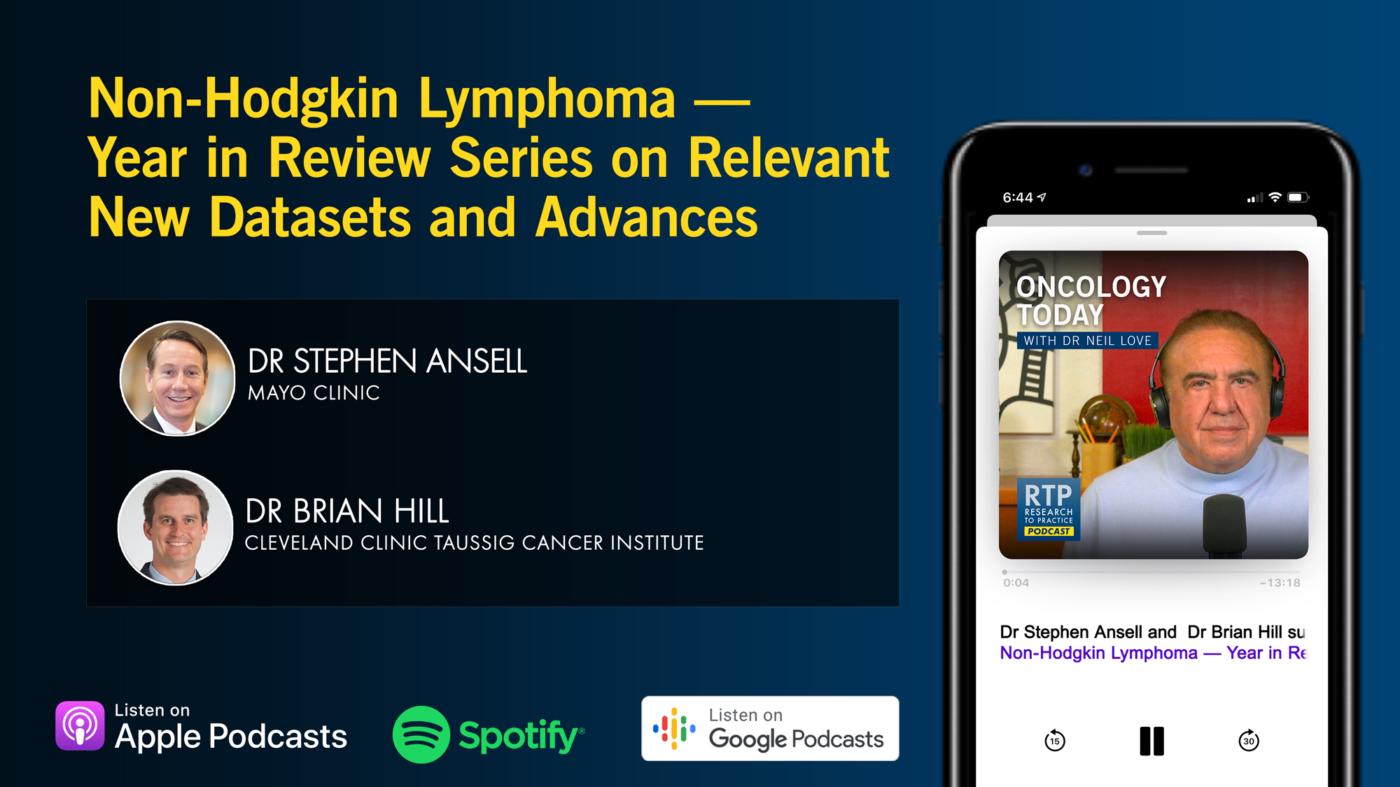

Slide 14
Current and Future Integration of Antibody-Drug Conjugates into the Management of Metastatic Breast Cancer
A CME/MOC-Accredited Live Webinar
Tuesday, September 30, 2025 5:00 PM – 6:00 PM ET
Faculty
Aditya Bardia, MD, MPH
Adam M Brufsky, MD, PhD
Moderator
Neil Love, MD

Slide 15
Data + Perspectives: Clinical Investigators Explore the Application of Recent Datasets in Current Oncology Care
A Multitumor Symposium in Partnership with Florida Cancer Specialists & Research Institute
Saturday, October 11, 2025 7:15 AM – 12:30 PM ET
The Ritz-Carlton Orlando, Grande Lakes | Orlando, Florida
Faculty
Emmanuel S Antonarakis, MD Harold J Burstein, MD, PhD
Matthew P Goetz, MD
Christopher Lieu, MD
Matthew Lunning, DO Heather McArthur, MD, MPH, FASCO
Sonali M Smith, MD
John Strickler, MD
Additional faculty to be announced.
Moderator
Neil Love, MD

Slide 16
Practical Perspectives: Experts Review Actual Cases of Patients with Endometrial Cancer
A CME/MOC-Accredited Live Webinar
Wednesday, October 15, 2025 5:00 PM – 6:00 PM ET
Faculty
Kathleen N Moore, MD, MS
Matthew A Powell, MD
Moderator
Neil Love, MD

Slide 17
Practical Perspectives: Experts Review Actual Cases of Patients with HER2-Positive Gastrointestinal Cancers
A CME/MOC-Accredited Live Webinar
Tuesday, October 21, 2025​ 5:00 PM – 6:00 PM ET
Faculty
Tanios Bekaii-Saab, MD
Kristen K Ciombor, MD, MSCI
Moderator
Neil Love, MD

Slide 18
Cancer Q&A: Understanding the Role and Reality of CAR (Chimeric Antigen Receptor) T-Cell Therapy for Non-Hodgkin Lymphoma
A Webinar Series for Clinicians and Patients, Developed in Partnership with CancerCare®
Patients
Clinicians
Wednesday, October 22, 2025
6:00 PM – 7:00 PM ET
Wednesday, November 12, 2025
5:00 PM – 6:00 PM ET
Faculty
Jeremy S Abramson, MD, MMSc
Loretta J Nastoupil, MD
Moderator
Neil Love, MD

Slide 19
Addressing Current Knowledge and Practice Gaps in the Community — Optimizing the Use of Oral Selective Estrogen Receptor Degraders for Metastatic Breast Cancer, Part 2
A CME/MOC-Accredited Live Webinar
Wednesday, October 29, 2025 5:00 PM – 6:00 PM ET
Faculty
Rinath M Jeselsohn, MD
Joyce O’Shaughnessy, MD
Moderator
Neil Love, MD

Slide 20
Optimizing Treatment for Patients with Relapsed/Refractory Chronic Lymphocytic Leukemia
A CME/MOC-Accredited Interactive Grand Rounds Series
October 2025 to March 2026
Steering Committee
Catherine C Coombs, MD
Matthew S Davids, MD, MMSc
Bita Fakhri, MD, MPH
Nicole Lamanna, MD
Jeff Sharman, MD
Jennifer Woyach, MD
Host a 1-hour session at your institution: Email GRTeam@ResearchToPractice.com or call (800) 233-6153

Slide 21
Thank you for joining us! Please take a moment to complete the survey currently up on Zoom. Your feedback is very important to us. Information on how to obtain CME and ABIM MOC credit will be provided at the conclusion of the activity in the Zoom chat room. Attendees will also receive an email in 1 to 3 business days with these instructions.

Slide 22
The Implications of Recent Datasets for the Current and Future Management of Non-Hodgkin Lymphoma
A CME/MOC-Accredited Live Webinar
Wednesday, September 17, 2025 5:00 PM – 6:00 PM ET
Faculty
Carla Casulo, MD
Brad S Kahl, MD
Moderator
Neil Love, MD

Slide 23
Faculty
Carla Casulo, MD
Associate Professor of Medicine
Division of Hematology/Oncology
Assistant Director, Cancer Research Training and Education
University of Rochester
Wilmot Cancer Institute
Rochester, New York
MODERATOR
Neil Love, MD Research To Practice Miami, Florida
Brad S Kahl, MD
Professor of Medicine
Washington University School of Medicine
Director, Lymphoma Program
Siteman Cancer Center
St Louis, Missouri

Slide 24
We Encourage Clinicians in Practice to Submit Questions
Feel free to submit questions now before the program begins and throughout the program.

Slide 25
Clinicians in the Audience, Please Complete the Pre- and Postmeeting Surveys
Quick Survey
Quick Poll

Slide 27
Current and Future Integration of Antibody-Drug Conjugates into the Management of Metastatic Breast Cancer
A CME/MOC-Accredited Live Webinar
Tuesday, September 30, 2025 5:00 PM – 6:00 PM ET
Faculty
Aditya Bardia, MD, MPH
Adam M Brufsky, MD, PhD
Moderator
Neil Love, MD

Slide 28
Data + Perspectives: Clinical Investigators Explore the Application of Recent Datasets in Current Oncology Care
A Multitumor Symposium in Partnership with Florida Cancer Specialists & Research Institute
Saturday, October 11, 2025 7:15 AM – 12:30 PM ET
The Ritz-Carlton Orlando, Grande Lakes | Orlando, Florida
Faculty
Emmanuel S Antonarakis, MD Harold J Burstein, MD, PhD
Matthew P Goetz, MD
Christopher Lieu, MD
Matthew Lunning, DO Heather McArthur, MD, MPH, FASCO
Sonali M Smith, MD
John Strickler, MD
Additional faculty to be announced.
Moderator
Neil Love, MD

Slide 29
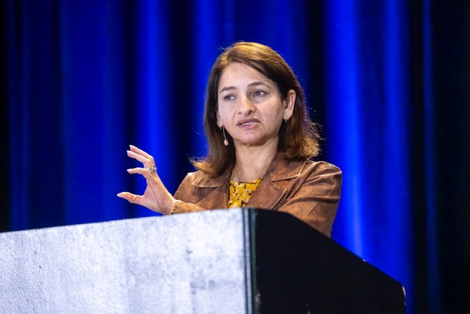
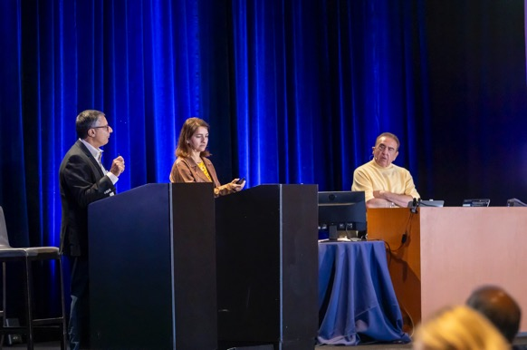
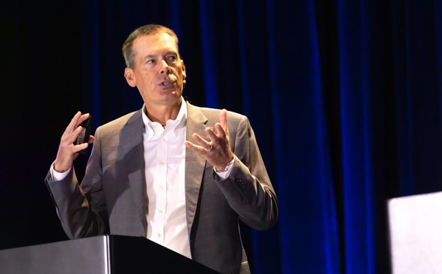
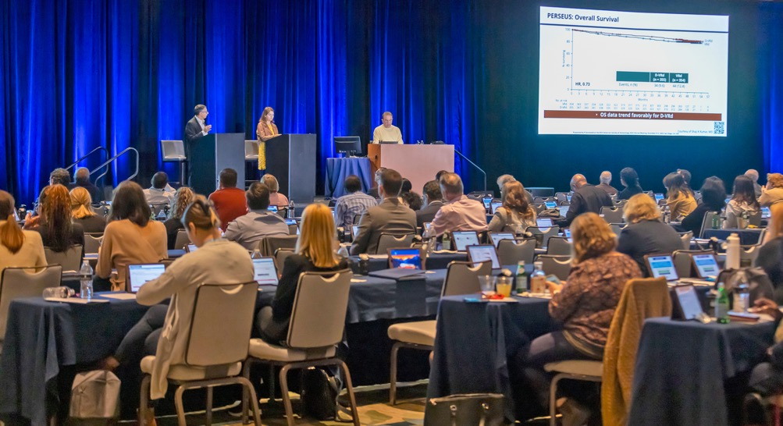
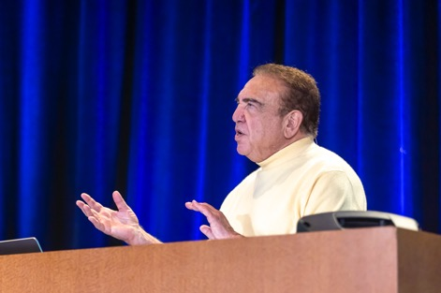
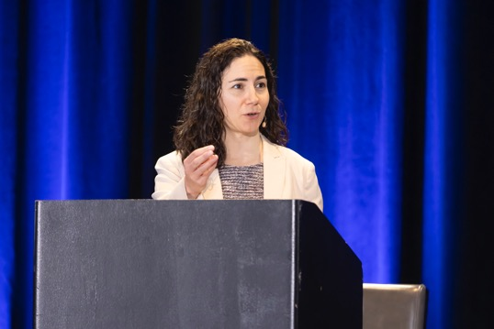
Florida Cancer Specialists/Research To Practice CME Annual Retreat Program 2005 to 2025

Slide 30
Data + Perspectives: Clinical Investigators Explore the Application of Recent Datasets in Current Oncology Care Agenda
7:15 AM – 9:15 AM – Breast Cancer
Localized Hormone Receptor (HR)-Positive Breast Cancer; Initial Therapy for Metastatic Disease
Therapeutic Options for Relapsed/Refractory HR-Positive Metastatic Breast Cancer
Management of HER2-Positive Breast Cancer
Treatment Approaches for Triple-Negative Breast Cancer
9:15 AM – 9:30 AM — Break
9:30 AM – 10:30 AM — Prostate Cancer
• Optimizing the Role of Hormonal Therapy in the Care of Patients with Prostate Cancer
• Other Available and Emerging Therapeutic Approaches
10:30 AM – 11:30 AM — Colorectal Cancer (CRC)
• Current and Future Role of Immune Checkpoint Inhibitors in the Management of CRC
• Other Biomarker-Based Strategies for Patients with CRC
11:30 AM – 12:30 PM — Diffuse Large B-Cell Lymphoma (DLBCL) and Follicular Lymphoma (FL)
• Available and Emerging Novel Therapies for DLBCL and FL
• Role of Chimeric Antigen Receptor T-Cell Therapy and Bispecific Antibodies in Treatment for DLBCL and FL
12:30 PM — Meeting Adjourns

Slide 31
Practical Perspectives: Experts Review Actual Cases of Patients with Endometrial Cancer
A CME/MOC-Accredited Live Webinar
Wednesday, October 15, 2025 5:00 PM – 6:00 PM ET
Faculty
Kathleen N Moore, MD, MS
Matthew A Powell, MD
Moderator
Neil Love, MD

Slide 32
Practical Perspectives: Experts Review Actual Cases of Patients with HER2-Positive Gastrointestinal Cancers
A CME/MOC-Accredited Live Webinar
Tuesday, October 21, 2025​ 5:00 PM – 6:00 PM ET
Faculty
Tanios Bekaii-Saab, MD
Kristen K Ciombor, MD, MSCI
Moderator
Neil Love, MD

Slide 33
Cancer Q&A: Understanding the Role and Reality of CAR (Chimeric Antigen Receptor) T-Cell Therapy for Non-Hodgkin Lymphoma
A Webinar Series for Clinicians and Patients, Developed in Partnership with CancerCare®
Patients
Clinicians
Wednesday, October 22, 2025
6:00 PM – 7:00 PM ET
Wednesday, November 12, 2025
5:00 PM – 6:00 PM ET
Faculty
Jeremy S Abramson, MD, MMSc
Loretta J Nastoupil, MD
Moderator
Neil Love, MD

Slide 34
Addressing Current Knowledge and Practice Gaps in the Community — Optimizing the Use of Oral Selective Estrogen Receptor Degraders for Metastatic Breast Cancer, Part 2
A CME/MOC-Accredited Live Webinar
Wednesday, October 29, 2025 5:00 PM – 6:00 PM ET
Faculty
Rinath M Jeselsohn, MD
Joyce O’Shaughnessy, MD
Moderator
Neil Love, MD

Slide 35
Optimizing Treatment for Patients with Relapsed/Refractory Chronic Lymphocytic Leukemia
A CME/MOC-Accredited Interactive Grand Rounds Series
October 2025 to March 2026
Steering Committee
Catherine C Coombs, MD
Matthew S Davids, MD, MMSc
Bita Fakhri, MD, MPH
Nicole Lamanna, MD
Jeff Sharman, MD
Jennifer Woyach, MD
Host a 1-hour session at your institution: Email GRTeam@ResearchToPractice.com or call (800) 233-6153

Slide 36
The Implications of Recent Datasets for the Current and Future Management of Non-Hodgkin Lymphoma
A CME/MOC-Accredited Live Webinar
Wednesday, September 17, 2025 5:00 PM – 6:00 PM ET
Faculty
Carla Casulo, MD
Brad S Kahl, MD
Moderator
Neil Love, MD

Slide 37
Dr Casulo — Disclosures
Consulting Agreements | AbbVie Inc, Genentech, a member of the Roche Group, Genmab US Inc, Incyte Corporation, Roche Laboratories Inc
Contracted Research | Genentech, a member of the Roche Group, Genmab US Inc, Gilead Sciences Inc
Honoraria | AbbVie Inc, Genentech, a member of the Roche Group, Incyte Corporation, Roche Laboratories Inc

Slide 38
Dr Kahl — Disclosures
Advisory Committees | AbbVie Inc, AstraZeneca Pharmaceuticals LP, BeOne, Bristol Myers Squibb, Genentech, a member of the Roche Group, GSK, Incyte Corporation, Lilly, Merck, Pfizer Inc, Roche Laboratories Inc
Contracted Research | BeOne, Roche Laboratories Inc
Data and Safety Monitoring Boards/Committees | BeOne, Bristol Myers Squibb, Roche Laboratories Inc

Slide 39
Dr Love — Disclosures
Dr Love is president and CEO of Research To Practice. Research To Practice receives funds in the form of educational grants to develop CME activities from the following companies: Aadi Bioscience, AbbVie Inc, ADC Therapeutics, Alexion Pharmaceuticals, Amgen Inc, Array BioPharma Inc, a subsidiary of Pfizer Inc, Arvinas, Astellas, AstraZeneca Pharmaceuticals LP, Aveo Pharmaceuticals, Bayer HealthCare Pharmaceuticals, BeOne, Black Diamond Therapeutics Inc, Blueprint Medicines, Boehringer Ingelheim Pharmaceuticals Inc, Bristol Myers Squibb, Clovis Oncology, Coherus BioSciences, CTI BioPharma, a Sobi Company, Daiichi Sankyo Inc, Eisai Inc, Elevation Oncology Inc, Exact Sciences Corporation, Exelixis Inc, Genentech, a member of the Roche Group, Genmab US Inc, Geron Corporation, Gilead Sciences Inc, GSK, Helsinn Therapeutics (US) Inc, Hologic Inc, ImmunoGen Inc, Incyte Corporation, Ipsen Biopharmaceuticals Inc, Jazz Pharmaceuticals Inc, Johnson & Johnson, Karyopharm Therapeutics, Kite, A Gilead Company, Kura Oncology, Legend Biotech, Lilly, MEI Pharma Inc, Merck, Mersana Therapeutics Inc, Mirati Therapeutics Inc, Mural Oncology Inc, Natera Inc, Novartis, Novartis Pharmaceuticals Corporation on behalf of Advanced Accelerator Applications, Novocure Inc, Nuvalent, Pfizer Inc, Pharmacyclics LLC, an AbbVie Company, Puma Biotechnology Inc, Regeneron Pharmaceuticals Inc, Rigel Pharmaceuticals Inc, R-Pharm US, Sanofi, Seagen Inc, Servier Pharmaceuticals LLC, SpringWorks Therapeutics Inc, Stemline Therapeutics Inc, Sumitomo Pharma America, Syndax Pharmaceuticals, Taiho Oncology Inc, Takeda Pharmaceuticals USA Inc, TerSera Therapeutics LLC, and Tesaro, A GSK Company.

Slide 40
Commercial Support
This activity is supported by educational grants from ADC Therapeutics and AstraZeneca Pharmaceuticals LP.
Research To Practice CME Planning Committee Members, Staff and Reviewers
Planners, scientific staff and independent reviewers for Research To Practice have no relevant conflicts of interest to disclose.

Slide 41
This educational activity contains discussion of non-FDA-approved uses of agents and regimens. Please refer to official prescribing information for each product for approved indications.

Slide 42
Agenda
Faculty Data and Case Presentation – Dr Kahl
• First-line treatment of diffuse large B-cell lymphoma (DLBCL)
• Management of relapsed/refractory DLBCL
Faculty Data and Case Presentation – Dr Casulo
• Follicular lymphoma
• Marginal zone lymphoma
• Mantle cell lymphoma

Slide 43
Key Datasets
Diffuse Large B-Cell Lymphoma — Dr Kahl
Calabretta E et al. The benefit of Pola-R-CHP in DLBclass-defined molecular subsets of newly diagnosed DLBCL in the POLARIX trial. ICML 2025;Abstract LBA1.
Matasar M et al. Polatuzumab vedotin, rituximab, gemcitabine and oxaliplatin (Pola-R-GemOx) for relapsed/refractory (R/R) diffuse large B-cell lymphoma (DLBCL): Results from the randomized phase III POLARGO trial. EHA 2025;Abstract S101.
Kerr D et al. Durable efficacy with fixed-duration epcoritamab + polatuzumab vedotin, rituximab, cyclophosphamide, doxorubicin, and prednisone (Pola-R-CHP) for 1L diffuse large B-cell lymphoma (EPCORE NHL-5). EHA 2025;Abstract S247.
Crombie JL et al. A multicenter phase II study of glofitamab plus polatuzumab-R-CHP for patients with high-risk diffuse large B-cell lymphoma. ICML 2025;Abstract 74.
Abramson JS et al. Glofitamab plus gemcitabine and oxaliplatin (Glofit-GemOx) in patients (pts) with relapsed/refractory (R/R) diffuse large B-cell lymphoma (DLBCL): 2-year (yr) follow-up of STARGLO. ASCO 2025;Abstract 7015.
Westin J et al. Mosunetuzumab plus polatuzumab vedotin is superior to R-GemOx in transplant-ineligible patients with R/R LBCL: Primary results of the phase III SUNMO trial. ICML 2025;Abstract LBA3.

Slide 44
Key Datasets
Diffuse Large B-Cell Lymphoma — Dr Kahl (Continued)
Alderuccio JP et al. Initial results from LOTIS-7: A phase 1b study of loncastuximab tesirine plus glofitamab in patients with relapsed/refractory (R/R) diffuse large B-cell lymphoma (DLBCL). EHA 2025;Abstract PS1911.
Carlo-Stella C et al. Updated safety run-in results from LOTIS-5: A phase 3, randomized trial of loncastuximab tesirine with rituximab versus immunochemotherapy in patients with R/R DLBCL/HGBL. EHA 2025;Abstract PS1957.
Armand P et al. WaveLINE-003: Phase 2/3 trial of zilovertamab vedotin plus standard of care in relapsed/refractory diffuse large B-cell lymphoma. ASCO 2025;Abstract 7005.
Kim TM et al. Safety and efficacy of AZD0486, a CD19 x CD3 T-cell engager, in relapsed or refractory diffuse large B-cell lymphoma. ASCO 2025;Abstract 7046.
Le Gouill S et al. SOUNDTRACK-E: A phase 1/2, open-label, multicenter study to evaluate the safety and efficacy of AZD0486 monotherapy or combination therapy in patients with mature B-cell malignancies. ASCO 2025;Abstract TPS7083.
Shadman M et al. TITANium: An open-label, global multicenter phase 1/2 study of AZD5492, a first-in-class subcutaneous CD8-guided tri-specific T-cell engager (TCE), in patients (pts) with relapsed or refractory (r/r) B-cell malignancies. ASCO 2025;Abstract TPS7091.

Slide 45
Key Datasets
Follicular, Marginal Zone and Mantle Cell Lymphoma — Dr Casulo
Trneny M et al. Tafasitamab (tafa) plus lenalidomide (len) and rituximab (R) for patients with relapsed or refractory follicular lymphoma (R/R FL): Results from the phase 3 INMIND study. EHA 2025;Abstract S230.
Thieblemont C et al. 4-year update of phase 2 ELARA trial: Clinical outcomes of tisagenlecleucel in patients (pts) with high-risk relapsed/refractory follicular lymphoma (R/R FL). EHA 2025;Abstract PS2150.
Ahmed S et al. Lisocabtagene maraleucel in R/R FL (TRANSCEND FL): Impact of prior lines of therapy, bendamustine exposure, and disease progression ≤ 24 months of initial systemic therapy. ICL 2025;Abstract 142.
Heß G et al. Fixed-duration subcutaneous mosunetuzumab demonstrates clinically relevant efficacy in patients with relapsed/refractory follicular lymphoma with high-risk features: Pivotal phase II study update. EHA 2025;Abstract PS1872.
Vitolo U et al. Epcoritamab monotherapy demonstrates deep and durable responses at 3-year follow-up in patients with relapsed/refractory follicular lymphoma. EHA 2025;Abstract PF881.
Flinn IW et al. Fixed duration subcutaneous (SC) mosunetuzumab (Mosun) in patients with previously untreated high-tumor burden follicular lymphoma (FL): Interim results from the phase II MorningSun study. ASCO 2025;Abstract 7014.
Phase 3 EPCORE FL-1 clinical trial met dual primary endpoints in patients with relapsed/refractory (R/R) follicular lymphoma (FL) [press release]. August 7, 2025. https://ir.genmab.com/news-releases/news- release-details/genmab-announces-phase-3-epcorer-fl-1-clinical-trial-met-dual.

Slide 46
Key Datasets
Follicular, Marginal Zone and Mantle Cell Lymphoma — Dr Casulo (Continued)
Palomba ML et al. Lisocabtagene maraleucel (liso-cel) in patients (pts) with relapsed or refractory (R/R) marginal zone lymphoma (MZL) in the phase 2 TRANSCEND FL study. ICML 2025;Abstract 55.
Burke JM et al. MorningSun: Open-label phase II trial of the efficacy and safety of subcutaneous mosunetuzumab (mosun SC) as frontline (1L) treatment in symptomatic patients with marginal zone lymphoma (MZL). EHA 2025;Abstract S232.
Dreyling M et al. Efficacy of rituximab-bendamustine with or without acalabrutinib in patients with untreated, high-risk mantle cell lymphoma: An analysis of the phase 3 ECHO trial. EHA 2025;Abstract S233.
Wang ML et al. Minimal residual disease with bendamustine-rituximab with or without acalabrutinib in patients with previously untreated mantle cell lymphoma: Results from the phase 3 ECHO trial. EHA 2025;Abstract PF882.
Jain P et al. Acalabrutinib in combination with rituximab is highly effective frontline treatment for older patients with mantle cell lymphoma. ICML 2025;Abstract 272.

Slide 47
Agenda
Faculty Data and Case Presentation – Dr Kahl
• First-line treatment of diffuse large B-cell lymphoma (DLBCL)
• Management of relapsed/refractory DLBCL
Faculty Data and Case Presentation – Dr Casulo
• Follicular lymphoma
• Marginal zone lymphoma
• Mantle cell lymphoma

Slide 48
Currently Approved ADCs in Oncology
Overview Discussion
Solid tumors | Hematologic cancers
Trastuzumab emtansine | Gemtuzumab ozogamicin
Sacituzumab govitecan | Brentuximab vedotin
Datopotamab deruxtecan | Inotuzumab ozogamicin
Trastuzumab deruxtecan | Polatuzumab vedotin
Mirvetuximab soravtansine | Loncastuximab tesirine
Tisotumab vedotin
Enfortumab vedotin
Telisotuzumab vedotin
https://www.fda.gov/drugs/resources-information-approved-drugs/oncology-cancer-hematologic-malignancies-approval-notifications

Slide 49
Diffuse Large B Cell Lymphoma
Brad Kahl, MD
Professor of Medicine

Slide 50
New Data in Frontline DLBCL
The benefit of Pola-R-CHP in DLBclass defined molecular subsets of new diagnosed DLBCL. Calabretta et al, ICML.
A multicenter phase II study of glofitamab plus Pola-R-CHP for patients with high-risk DLBCL. Crombie et al, ICML.
Durable efficacy with fixed duration epcoritamab plus Pola-R-CHP for 1L DLBCL (EPCORE NHL-5). Kerr et al, EHA.

Slide 51
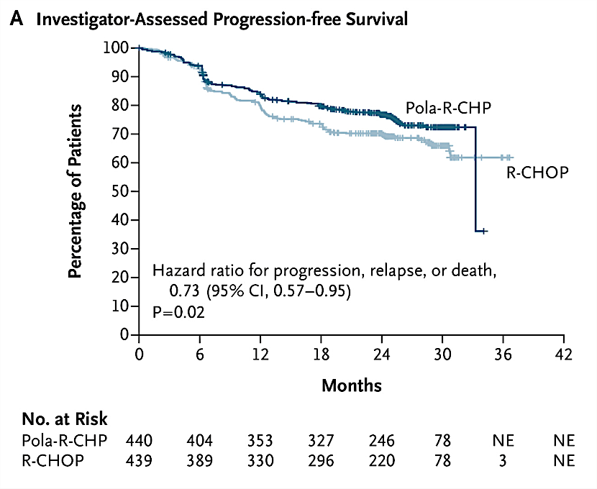

POLARIX Clinical Trial
Trial compared efficacy of Pola-R-CHP (polatuzumab [anti-CD79B] vedotin plus rituximab, cyclophosphamide, doxorubicin, and prednisone) versus R-CHOP (R-CHP and vincristine) in newly diagnosed patients with intermediate- to high- risk (IPI 2-5) DLBCL.
PFS benefit for Pola-R-CHP at 2 years (Pola-R-CHP, 76.7% [95%CI 72.7-80.8] vs R-CHOP, 70.2% [95%CI 65.8-74.6])
PFS benefit persisted at 5 years.
Exploratory subgroup analysis suggested benefit for Pola-R-CHP in multiple subgroups, including transcriptionally-defined cell-of-origin ABC subtype of DLBCL
Tilly H, Morschhauser F, Sehn LH, et al. N Engl J Med. 2022;386(4):351-363.
Salles G et al., ASH 2024

Slide 52
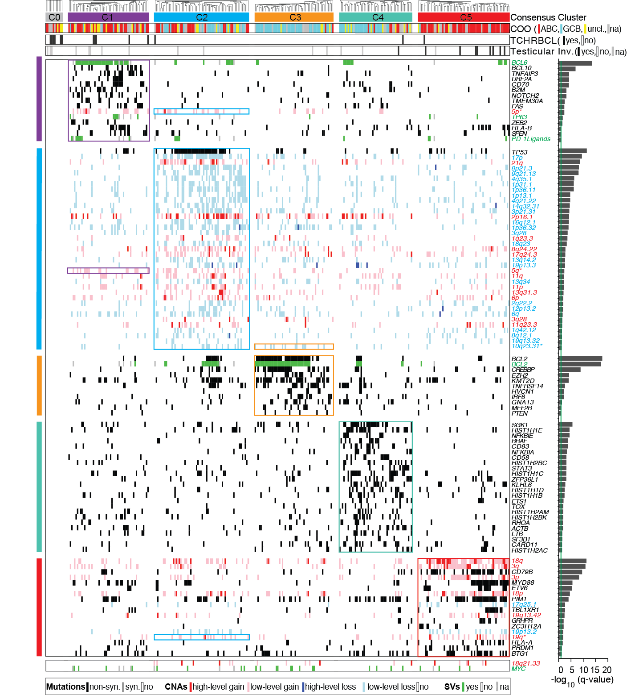
DLBCL Subsets with Discrete Genetic Features and Outcomes
(C1) Lower risk subset of ABC-enriched DLBCLs with genetic features of an extrafollicular, possibly marginal zone, origin
(C2) ABC/GCB-independent group of tumors with biallelic inactivation of TP53, 9p21.3/CDKN2A copy loss and associated genomic instability
(C3) Higher risk GCB DLBCLs with BCL2 SVs, inactivating mutations and/or copy loss of PTEN, mutations of additional BCR/PI3K signaling modifiers and epigenetic enzymes
(C4) Lower risk group of GCB-enriched DLBCLs with distinct alterations in JAK/STAT and BRAF pathway components and multiple histones
(C5) Higher risk ABC DLBCLs with near-uniform BCL2 copy gain, frequent activating MYD88^{L265P} and CD79B mutations and extranodal tropism
All types of alterations (mutations, CNAs, SVs) needed to capture structure
Additional genetic heterogeneity beyond previously defined transcriptional subtypes (ABC, GCB)
Chapuy, Stewart, Dunford, et al Nat Med 2018; 24:679-69

Slide 53
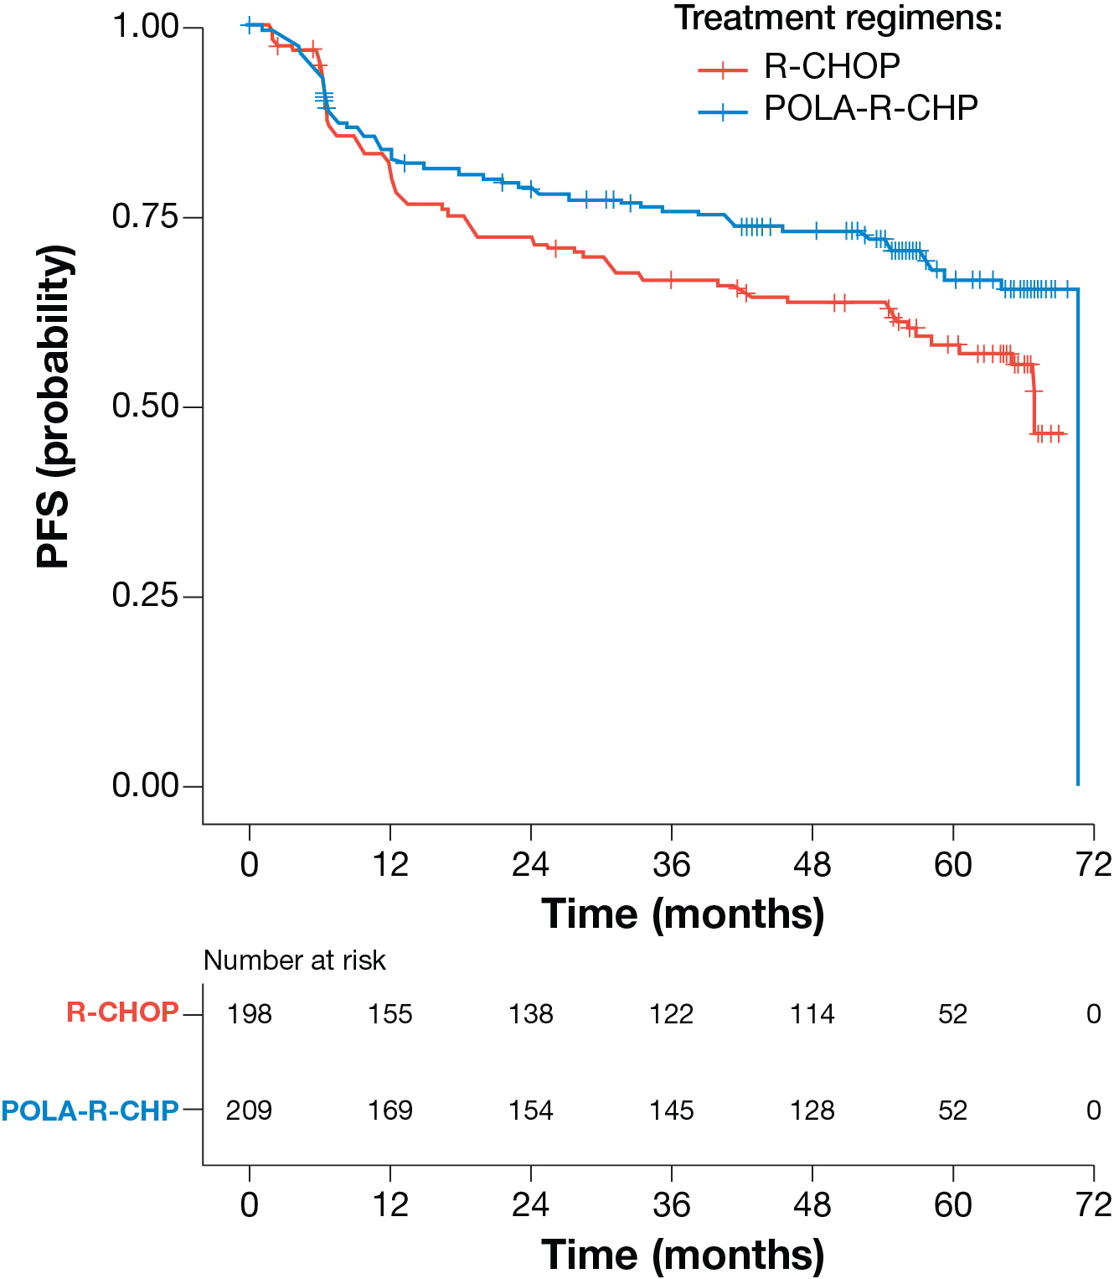
Study Population
Treatment regimen:
N=407 patients
5-year PFS estimates:
Pola-R-CHP: 66.7% (95% CI 59.7-74.5)
R-CHOP: 58.1% (95% CI 51.0-66.3)
Treatment arms balanced for clinical prognostic factors
Calabretta E et al. ICML 2025;Abstract LBA1.

Slide 54
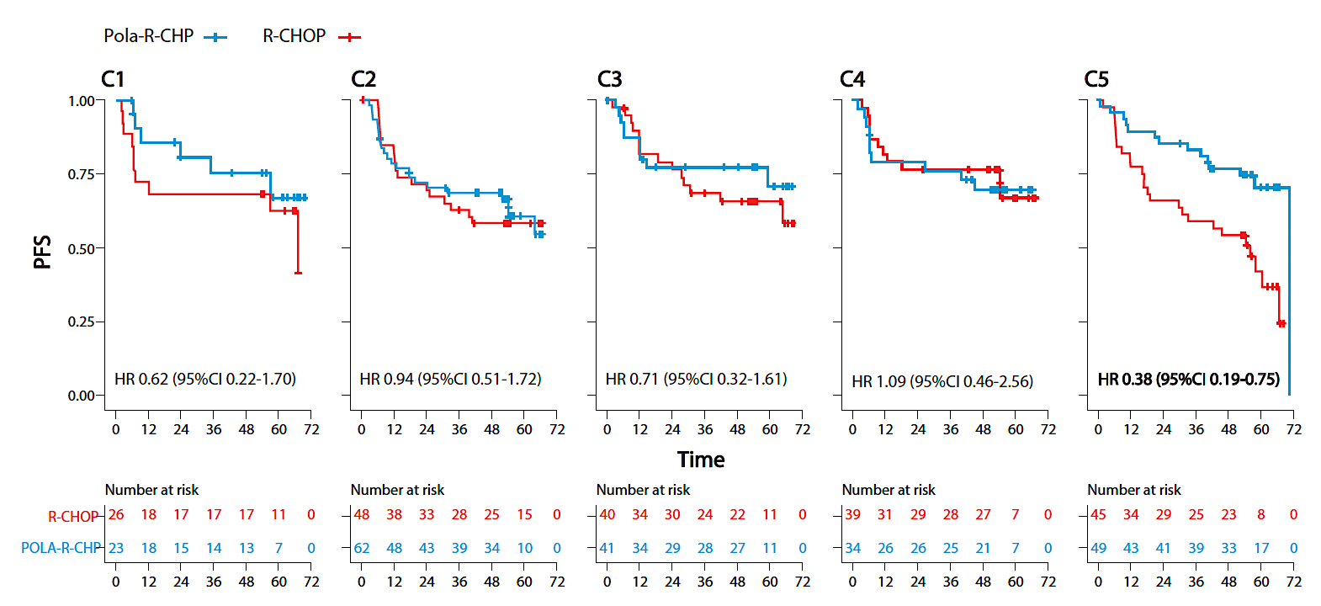
Benefit of Pola-R-CHP in Patients with Cluster 5 DLBCLs
PFS (probability)
Time (months)
Patients with C5 DLBCLs – 5-yr PFS higher in Pola-R-CHP versus R-CHOP treatment arm
Pola-R-CHP 70.4% (95%CI 57.6-86.1)
R-CHOP 42.0% (95% CI 28.0-63.0)
Hazard ratio (HR) for Pola-R-CHP vs R-CHOP 0.38 (95% CI 0.19-0.75, p=0.005) in patients with C5 DLBCLs
Pola-containing regimen abrogated the predicted poor outcome in C5 tumors.
In contrast, 5-yr PFSs and HRs comparable for patients with C1-C4 DLBCLs in the two treatment arms
Calabretta E et al. ICML 2025;Abstract LBA1.

Slide 55
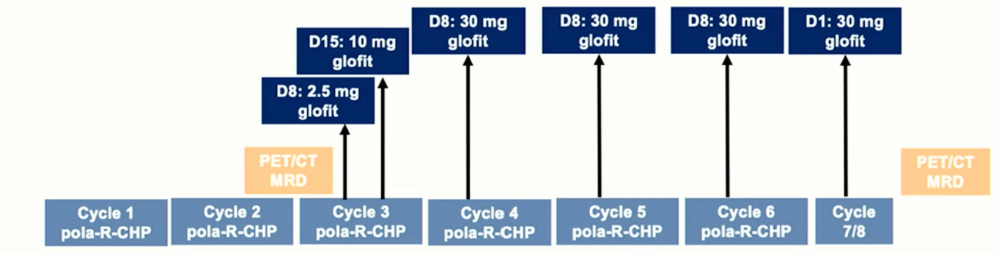
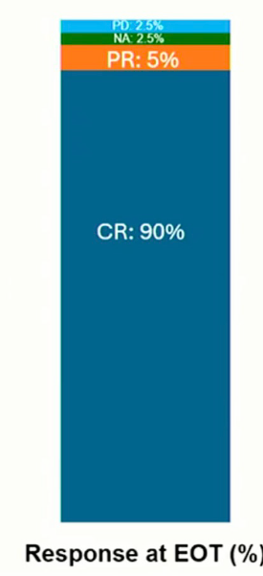
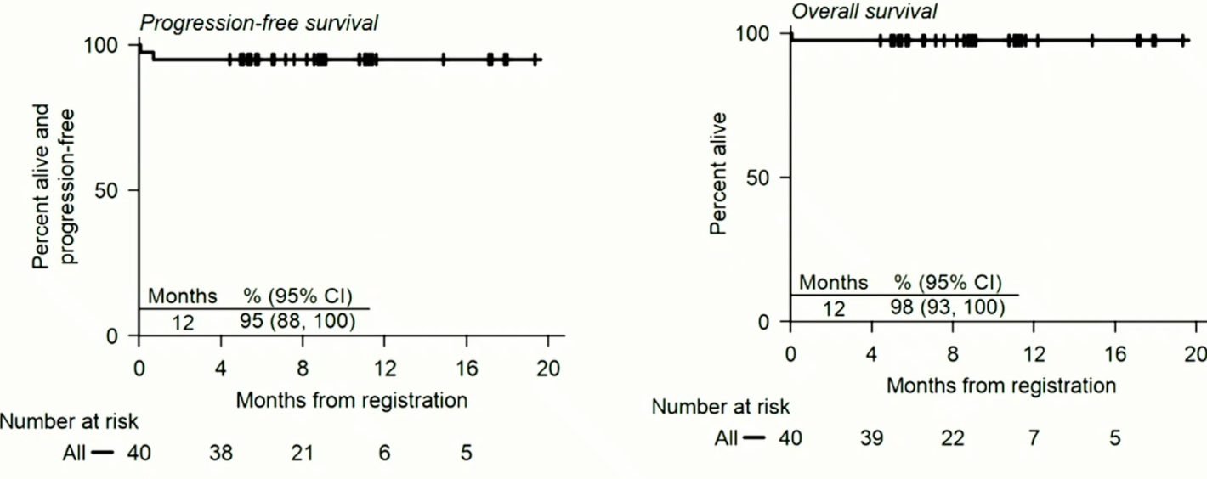
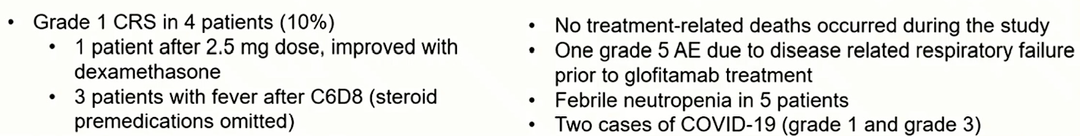
Glofitamab + Pola-R-CHP
Crombie et al. ICML 2025

Slide 56
Epco-Pola-R-CHP in 1L DLBCL
Eligibility
DLBCL NOS | HGBCL | FL G3B
IPI 2 – 5
Treatment
6 cycles Pola-R-CHP
8 cycles of Epco (with dose ramp-up)
G-CSF support
Endpoints
ORR/CRR, time to response, safety
EHA. Abstract 247. Kerr et al.

Slide 57
Epco-Pola-R-CHP in 1L DLBCL
Median follow up 16 months
ORR 100% (97% CR)
Median time to response 2.7 months
Hematologic toxicity was common
65% neutropenia
51% CRS (G1-G2, no grade 3)
No ICANS
EHA. Abstract 247. Kerr et al.

Slide 58
New combinations vs. R-GemOx in R/R DLBCL
Glofit-GemOx in patient with R/R DLBCL: 2 year follow up of STARGLO. Abramson et al, ASCO.
Pola-R-GemOx for R/R DLBCL: Results from the phase III POLARGO Trial. Matasar et al, EHA.
Mosunetuzumab plus Polatuzumab Vedotin is superior to R-GemOx in transplant ineligible patients with R/R DLBCL: Results from the phase III SUNMO trial. Westin et al, ICML.

Slide 59
STARGLO: a randomized, global, Phase III trial
Glofit-GemOx (n=183)
Glofitamab
30 mg administered on Day 1 of each cycle
Patients R/R DLBCL (N=274)
R/R DLBCL NOS after ≥1 prior systemic therapy
Patients with 1 prior line must be transplant ineligible
ECOG PS 0–2
Glofitamab plus gemcitabine and oxaliplatin*
Glofitamab step-up dosing in Cycle 1,
30 mg administered on Day 1 from Cycle 2 onwards
Cycles 9–12
R 2:1
Cycles 1–8 (21-day cycles)
R-GemOx (n=91)
Stratification factors
Relapsed vs refractory disease‡
1 vs ≥2 prior lines of therapy
Rituximab† plus gemcitabine and oxaliplatin Administered on Day 1 of each cycle
Primary endpoint: OS
Key secondary endpoints: PFS, CR rate, DoCR (all IRC-assessed)
Safety endpoints: incidence, nature, and severity of AEs
Additional analyses: landmark analysis at 1 year of patients in CR at EOT, subgroup analyses in 2L patients, ctDNA analyses, and immune recovery
*Gemcitabine 1000 mg/m² and oxaliplatin 100 mg/m². In C1, Gpt administered on D1, GemOx on D2, followed by Glofit 2.5 mg on D8 and Glofit 10 mg on D15; in C2–8, Glofit 30 mg and GemOx are administered on D1. †Rituximab 375 mg/m². ‡Relapsed disease: recurrence following a response that lasted ≥6 months after completion of the last line of therapy; refractory disease: disease that did not respond to, or that progressed <6 months after completion of the last line of therapy. 2L, second-line; AEs, adverse events; C, cycle; ctDNA, circulating tumor DNA; D, day; DoCR, duration of complete response; ECOG PS, Eastern Cooperative Oncology Group performance status; EOT, end of treatment; Gpt, obinutuzumab pre-treatment; IRC, independent review committee; R 2:1, patients randomized in a 2:1 ratio.
NCT04408638. Available at: https:www.clinicaltrials.gov.
Abramson JS et al. ASCO 2025;Abstract 7015.

Slide 60
Sustained PFS benefit with Glofit-GemOx
Progression-free survival with extended follow up
100
Median PFS follow up: 17.2 months
R-GemOx (n=91)
Outcome | R-GemOx (n=91) | Glofit-GemOx (n=183)
PFS, median (95% CI); months | 3.6 (2.5, 7.1) | 13.8 (8.8, 30.0)
18-month PFS, % (95% CI) | 23.0 (11.5, 34.4) | 46.5 (38.5, 54.5)
ORR, % (95% CI) | 40.7 (30.5, 51.5) | 68.3 (61.0, 75.0)
CR rate, % (95% CI) | 25.3 (16.8, 35.5) | 58.5 (51.0, 65.7)
DoCR, median (95% CI); months | 24.2 (6.9, NE) | NE (27.2, NE)
Ongoing CR, % (n) | 17.6 (16) | 42.1 (77)
Glofit-GemOx (n=183)
80
Censored
60
13.8 months median (95% CI: 8.8, 30.0)
PFS (%)
40
HR (95% CI): 0.41 (0.29, 0.58)
p-value <0.001*
20
3.6 months median (95% CI: 2.5, 7.1)
0
0
3
6
9
12
15
18
21
24
27
30
33
36
Time (months)
No. of patients at risk
R-GemOx
91
34
22
14
10
8
5
4
2
2
NE
NE
NE
Glofit-GemOx
183
129
106
90
69
61
48
35
25
20
12
6
NE
Patients treated with Glofit-GemOx showed a sustained PFS benefit versus R-GemOx after 2 years of follow up
CCOD: June 17, 2024. Median follow up for CR: 17.7 months. Outcomes were IRC-assessed. *p-value is descriptive. ORR, overall response rate.
Abramson JS et al. ASCO 2025;Abstract 7015.

Slide 61
Sustained OS benefit with Glofit-GemOx
Overall survival with ~2 years of follow up
100
R-GemOx (n=91)
Outcome | R-GemOx (n=91) | Glofit-GemOx (n=183)
2-year follow up analysis (median follow up: 24.7 months)
OS, median (95% CI); months | 13.5 (7.9, 18.5) | NE (19.2, NE)
HR (95% CI) | 0.60 (0.42, 0.85)
p-value* | 0.003
24-month OS, % (95% CI) | 33.6 (22.9, 44.2) | 54.4 (46.8, 62.0)
Glofit-GemOx (n=183)
80
Censored
60
OS (%)
40
NE median (95% CI: 19.2, NE)
20
13.5 months median (95% CI: 7.9, 18.5)
0
0
3
6
9
12
15
18
21
24
27
30
33
36
39
42
26.9% of Glofit-GemOx-treated patients and 57.1% of R-GemOx-treated patients had received ≥1 NALT
Time (months)
No. of patients at risk
R-GemOx
91
68
55
46
42
34
30
22
15
11
9
4
2
NE
NE
Glofit-GemOx
183
159
135
120
108
98
86
74
56
43
29
14
4
1
NE
Clinically meaningful OS benefit for Glofit-GemOx versus R-GemOx remains after 2 years of follow up
CCOD: June 17, 2024. *p-value is descriptive. CI, confidence interval; HR, hazard ratio; NALT, new anti-lymphoma treatment; NE, not evaluable.
Abramson JS et al. ASCO 2025;Abstract 7015.

Slide 62
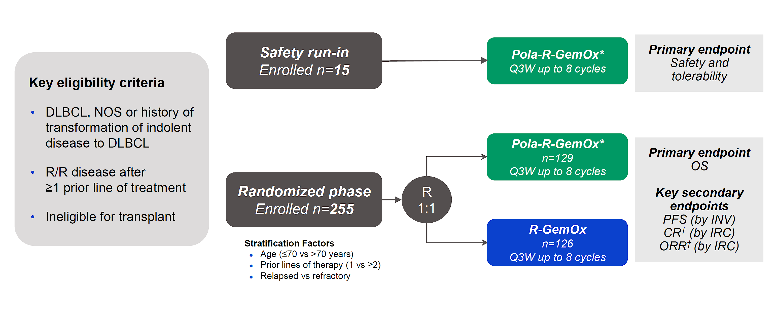
PolaRGO
Matasar et al, EHA. Abstract S101.

Slide 63
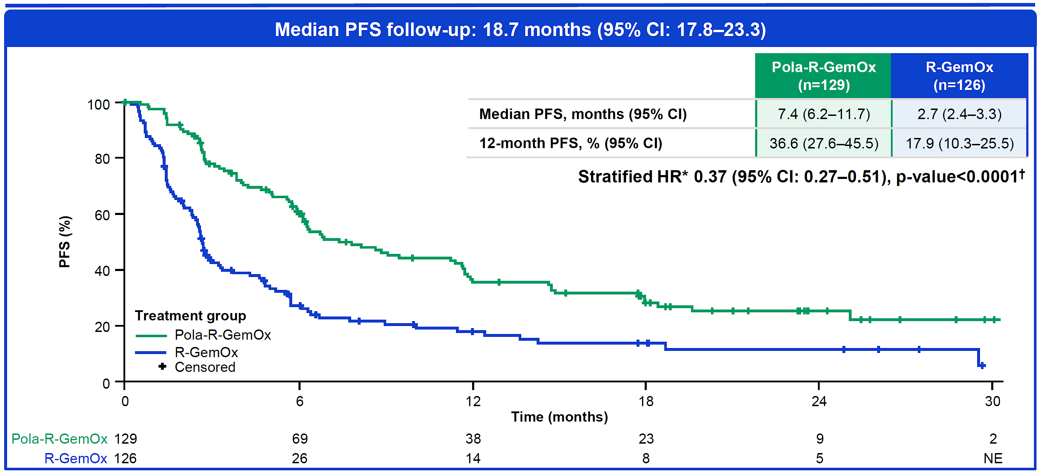
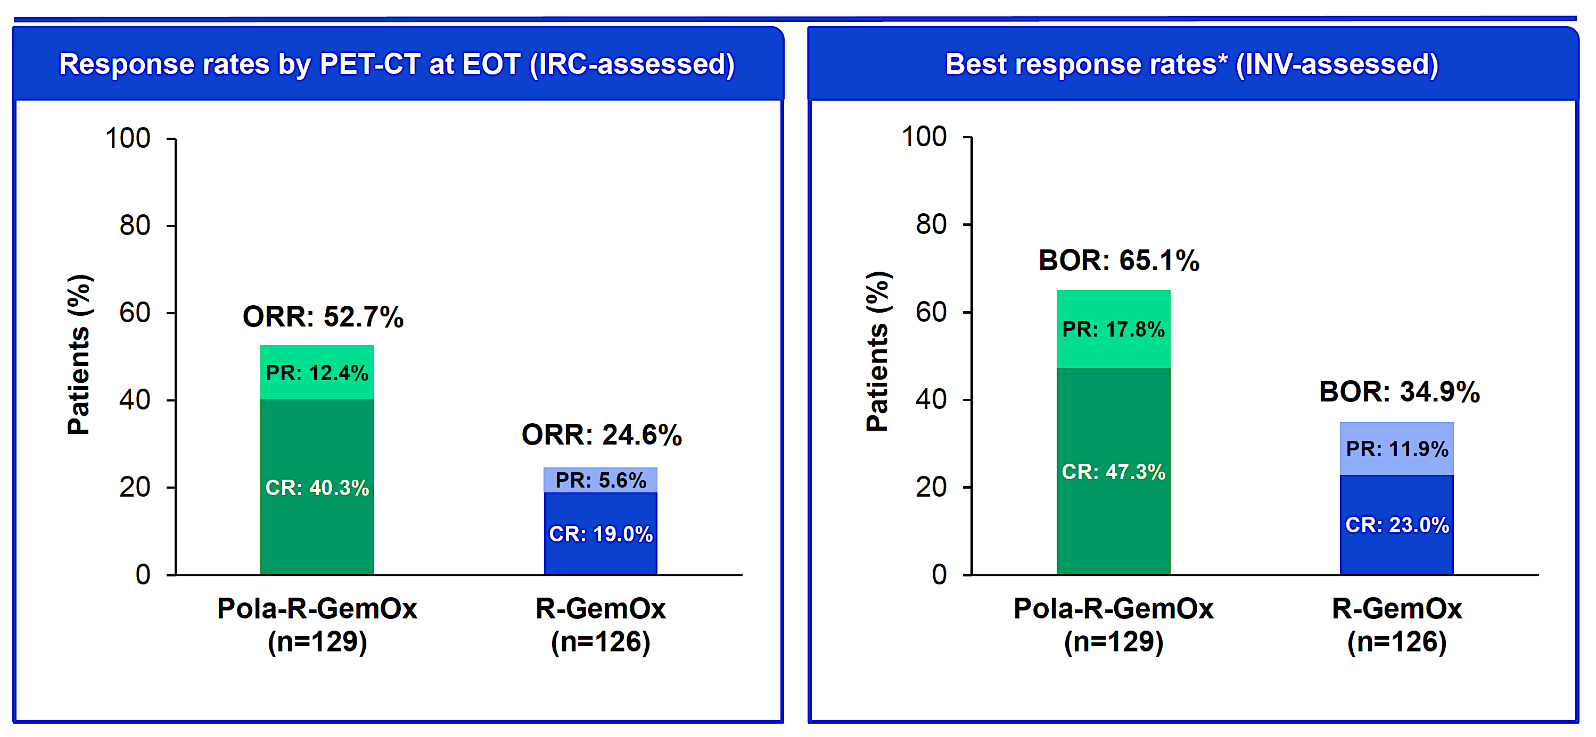
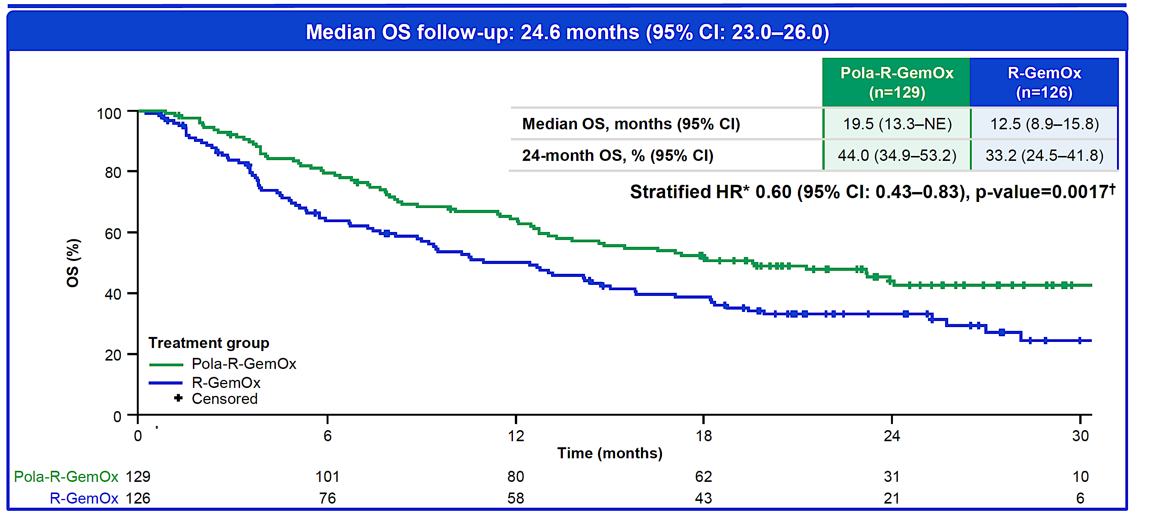
PolaRGO
Matasar et al, EHA. Abstract S101.

Slide 64
SUNMO Study design
Key eligibility
R/R LBCL with ≥1 prior therapy and ASCT-ineligible:
DLBCL NOS
Transformed FL
HGBCL
Grade 3B FL
Outpatient Mosun SC (8 cycles) + Pola IV (6 cycles) (21-day cycles)
Mosun
5mg
Mosun
45mg
Mosun
45mg
2:1
Screen
C1 D1 D8 D15
C2
C3
C4
C5
C6
C7
C8
Follow up after drug completion
Screen | C1 D1 D8 D15 | C2 | C3 | C4 | C5 | C6 | C7 | C8 | Follow up after drug completion
Screening
8 weeks
16 weeks
24 weeks
…
9 months
…
30 months
R-GemOx IV (8 x 14–21-day cycles*)
Stratification factors
1 vs ≥2 prior lines of systemic therapy
Relapsed vs refractory disease
Screen
C1
C2
C3
C4
C5
C6
C7
C8
Follow up after drug completion
Screen | C1 | C2 | C3 | C4 | C5 | C6 | C7 | C8 | Follow up after drug completion
Screening
8 weeks
16 weeks
24 weeks
…
9 months
…
30 months
*14-day cycles unless delayed to 21-day cycles if needed in case of hematologic toxicity. C, cycle; D, day; DLBCL, diffuse large B-cell lymphoma; FL, follicular lymphoma; HGBCL, high-grade B-cell lymphoma; IV, intravenous; NOS, not otherwise specified; SC, subcutaneous.
Mosun
Pola
R-GemOx
Tumor assessment
Presented as LBA3 by Westin et al, ICML 2025

Slide 65
Mosun-Pola significantly prolonged progression-free survival versus R-GemOx
Primary endpoint: Progression-free survival by IRC
100
Mosun-Pola (n=138)
12-month PFS, % (95% CI):
Mosun-Pola: 48.5 (39.6–57.4)
R-GemOx: 17.8 (5.4–30.3)
R-GemOx (n=70)
Mosun-Pola demonstrates a 59% risk reduction for progression or death compared with R-GemOx
80
Censored
60
PFS (%)
40
20
0
0
3
6
9
12
15
18
21
24
27
30
n at risk
Time (months)
Mosun-Pola
138
108
65
54
49
40
34
20
8
5
NE
R-GemOx
70
33
9
6
5
4
4
3
1
NE
NE
Clinical cut-off date: 17 February, 2025. PFS is censored at earliest of NALT or two or more missing tumor assessments, whichever occurred first. CI, confidence interval; HR, hazard ratio; NALT, new anti-lymphoma therapy; NE, non estimable
Presented as LBA3 by Westin et al, ICML 2025

Slide 66
Three new combinations vs. R-GemOx
 | ORR | CR | 12 month PFS
R-GemOx | 40% | 25% | 18%
Pola-R-GemOx | 65% | 47% | 36%
Glofit-GemOx | 68% | 58% | 50%
Mosun-Pola | 70% | 51% | 48%
What is “preferred” regimen going forward?
I have been favorably impressed with single agent Glofitamab in R/R DLBCL (CR rate 40%) but not available until 3rd line.
I can see myself starting patients on Glofit-GemOx (2nd line frail) and dropping GemOx after 2 cycles and continuing with single agent Glofitamab.
I could see Mosun-Pola getting good community uptake (less CRS with Mosun).

Slide 67
New ADC Data in R/R DLBCL
WaveLINE-003: Phase 2/3 trial of zilovertamab vedotin plus standard of care in R/R DLBCL. Armand et al, ASCO.
Updated safety run in results from Lotis-5: A phase III trial of Lonca-T plus rituximab vs. immunochemotherapy in patients with R/R DLBCL. Carlo-Stella et al, EHA.
Initial Results from LOTIS-7: A phase 1B study of Lonca-T plus Glofitamab in patients with R/R DLBCL. Alderuccio et al, EHA.

Slide 68
waveLINE-003 Phase 3 Study Design (NCT05139017)
Zilovertamab vedotin in combination with R-GemOx versus R-GemOx in R/R DLBCL
Key Eligibility Criteria
Confirmed R/R DLBCL
measurable by PET by
BICR per Lugano
≥1 line of therapy
ECOG PS 0-2
1.75 mg/kg ZV + R-GemOx
(IV Q3W up to 6 cycles)
Efficacy and Survival
Follow-up
N≈200
R
1:1
R-GemOx
(IV Q3W up to 6 cycles)
Endpoints:
Primary: Progression-free survival per Lugano criteria by BICR, and overall survival
Secondary: Objective response and duration of response per Lugano criteria by BICR
Armand P et al. ASCO 2025;Abstract 7005.
Notes:
The phase 3 portion of waveLINE-003 will enroll about 200 participant to randomize 1:1 into receiving 1.75 ZV plus R-GemOX or R-GemOX
The primary endpoints are PFS per Lugano by blinded independent central review, and overall survival
The secondary endpoints are objective response and duration of response per Lugano by blinded independent central review

Slide 69
LOTIS-5 Trial Design Phase 3 trial of Lonca in combination with rituximab^{1,2}
Treatment Period
Follow-Up Period
Lonca 0.15 mg/kg +
rituximab 375 mg/m²
Q3W for 2 cycles, then
Lonca 0.075 mg/kg +
rituximab 375 mg/m²
Q3W for up to 6 additional cycles
Lonca 0.15 mg/kg + rituximab 375 mg/m²
Q3W for 2 cycles, then
Lonca 0.075 mg/kg + rituximab 375 mg/m²
Q3W for up to 6 additional cycles
For both parts of the study,
irrespective of disease status,
patients will be followed for up to 4 years after EOT until withdrawal of consent,
loss to follow-up, or death—whichever occurs first
Nonrandomized Safety Run-in
N=20
Randomized 1:1
Target N=420
End of Treatment
R-GemOx: rituximab 375 mg/m² +
gemcitabine 1000 mg/m² +
oxaliplatin 100 mg/m²
Q2W for up to 8 cycles
KEY INCLUSION/EXCLUSION CRITERIA
Adults with a pathologic diagnosis of R/R DLBCL (including DLBCL transformed from indolent lymphoma) or HGBCL, with MYC and BCL2 and/or BCL6 rearrangements R/R disease following ≥1 multi-agent systemic treatment regimen Measurable disease (2014 Lugano classification) Not a candidate for SCT based on performance status, advanced age, and/or significant medical comorbidities (as considered by the investigator) If patient had received previous CD19 directed therapy, biopsy proven CD19 expression required ECOG performance status of 0-2 Excludes previous treatment with Lonca or R-GemOx
PRIMARY ENDPOINTS
SECONDARY ENDPOINTS
PFSª by independent central review
OS, ORR, CRR, DOR
Frequency and severity of AEs and laboratory parameters
PK parameters, for Lonca total Ab, PBD-conjugated Ab, and free SG3199
ADA titers to Lonca
Changes in PROs from baseline
ªDefined as time between randomization and the first documentation of recurrence or progression, or death from any cause.
Abbreviations: Ab, antibody; ADA, antidrug antibody; CRR, complete response rate; DOR, duration of response; ECOG, Eastern Cooperative Oncology Group; EOT, end of treatment; PK, pharmacokinetics; ORR, overall response rate; OS, overall survival; PBD, pyrrolobenzodiazepine; PRO, patient reported outcome; Q2W, every 2 weeks; Q3W, every 3 weeks; SCT, stem cell transplant; R-GemOx, rituximab + gemcitabine + oxaliplatin.
1. Carlo-Stella C, et al. Updated Safety Run-in Results From LOTIS-5: A Phase 3, Randomized Trial of Loncastuximab Tesirine With Rituximab Versus Immunochemotherapy in Patients With R/R DLBCL/HGBL. Poster presented at the European Hematology Association 30th Annual Congress (EHA 2025). June 12-15, 2025. Milan, Italy.
2. ADCT Therapeutics SA. Study to evaluate loncastuximab tesirine with rituximab versus immunochemotherapy in participants with relapsed or refractory diffuse large B-cell lymphoma (LOTIS 5). ClinicalTrials.gov registration number: NCT04384484. Updated May 30, 2025. Accessed June 2, 2025. https://clinicaltrials.gov/ct2/show/NCT04384484.

Slide 70
LOTIS-5 Safety Run-in: Efficacy Results^{1,a}
The ORR by central review was 80% (16/20)
A total of 50% (10/20) and 30% (6/20) patients attained CR and PR, respectively
The median DOR was 8.0 months (95% CI, 3.2-NE)
The median PFS was 8.3 months (95% CI, 4.5-NE)
No new safety signals were identified
Trial has progressed to randomization
Efficacy outcomes in safety run-in population (N=20)
ORR (95% CI), % | 80.0 (56.3, 94.3)
CR rate (95% CI), % | 50.0 (27.2-72.8)
Median DOR (95% CI), months | 8.0 (3.2-NE)
Median PFS (95% CI), months | 8.3 (4.5, NE)
Efficacy outcomes in responders (n=16)
Median DOR (95% CI), months | 8.0 (3.19-NE)
Events (%), n | 5 (31.3)
Efficacy outcomes in complete responders (n=10)
Median DOR (95% CI), months | NE (3.19-NE)
Events (%), n | 3 (30.0)
MRD results in patients with ctDNA measurements (n=8)
CR and MRD negative (%), n | 4 (50.0)
MRD negative at end of treatment (%), n | 4 (50.0)
ªOctober 4, 2024, data cutoff.
Abbreviations: CR, complete response; ctDNA, circulating tumor DNA; DOR, duration of response; EOT, end of therapy; MRD, minimal residual disease; NE, not estimable; ORR, overall response rate; PFS, progression-free survival; PR, partial response; SCT, stem cell transplant.
1. Carlo-Stella C, et al. Updated Safety Run-in Results From LOTIS-5: A Phase 3, Randomized Trial of Loncastuximab Tesirine With Rituximab Versus Immunochemotherapy in Patients With R/R DLBCL/HGBL. Poster presented at the European Hematology Association 30th Annual Congress (EHA 2025). June 12-15, 2025. Milan, Italy.

Slide 71
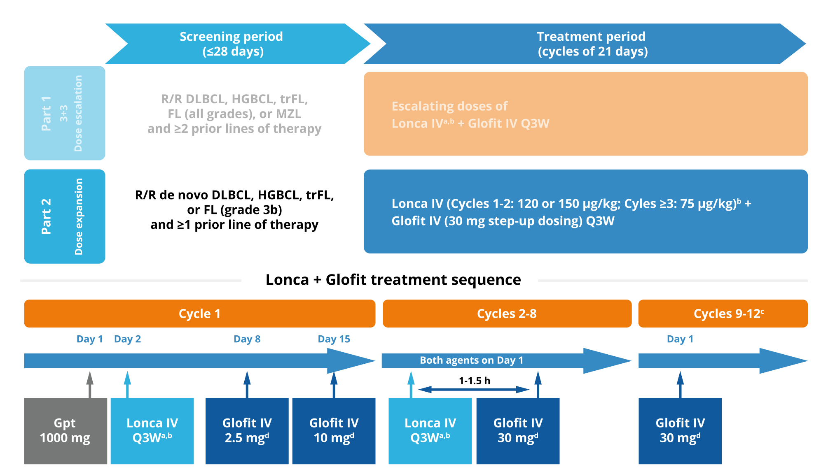
LOTIS-7 Study Design & Patient Population
Study population
Patients with 3L+ R/R B-NHL (part 1) and 2L+ R/R LBCL (part 2)
ECOG PS score of 0-2
Prior autologous SCT (>100 days) or CAR-T therapy (>100 days) is allowed
Measurable disease (per 2014 Lugano Classification)
Excludes patients with clinically significant third-space fluid accumulation
Endpoints
Primary: safety and tolerability; MTD and/or RDE
Secondary: ORR, DOR, CR rate, PFS, RFS, and OS; PK and immunogenicity
Exploratory: Glofit concentration in circulation; biomarker and PK correlations with clinical outcomes
Cycles 2-8
Dex:
D1
D2
D3
D8
D15
D0
D1
D2
Alderuccio JP et al. EHA 2025;Abstract PS1911.
Notes:
Dex premed dosing:
For Lonca: Dex 4 mg PO or IV BID the day before, day of, and day after
For Glofit: Dex 20 mg IV at least 1 hr prior to Glofit
For C2+ when Lonca and Glofit are given together: Dex 4 mg BID the day before, Dex 20 mg the day of (given prior to Lonca the morning of treatment), and Dex 4 mg BID the day after

Slide 72
Best Overall Response & Duration of Response
Efficacy Evaluable Population (N=30)ª
Best overall response^{b}
ORR: 93.3
ORR: 93.3
ORR: 93.3
Duration of response
Characteristic, n (%) | Glofit + Lonca, 120 μg/kg^{c} (n=15) | Glofit + Lonca, 150 μg/kg^{c} (n=15) | All dose levels (N=30)
DOR^{d} Median | (n=14) NE | (n=14) NE | (n=28) NE
Time to first response (CR or PR) Median, days | (n=14) 42.0 | (n=14) 42.0 | (n=28) 42.0
Time to first CR Median, days | (n=13) 80.0 | (n=13) 42.0 | (n=26) 70.5
CR
PR
Glofit + Lonca, 120 μg/kg^{c} (n=15)
Glofit + Lonca, 150 μg/kg^{c} (n=15)
All dose levels (N=30)
Data cutoff: April 14, 2025.
CR, complete response; DOR, duration of response; Glofit, glofitamab; Lonca, loncastuximab tesirine; NE, not estimable; ORR, overall response rate; PR, partial response.
ªThe efficacy evaluable population (N=30) included all patients who received ≥1 dose of the study drug with a valid baseline and ≥1 valid postbaseline disease assessment. Patients who did not have a postbaseline assessment owing to early clinical progression or death were also included. ^{b}Percentages do not add up to total due to rounding. ^{c}When the starting dose of Lonca is 120 μg/kg or 150 μg/kg, the dose will be reduced to 75 μg/kg for Cycles ≥3. ^{d}In the efficacy evaluable population, the DOR and probability of maintaining an event-free response were evaluated in responders (n=28), including all patients who had a best response of CR or PR.
Alderuccio JP et al. EHA 2025;Abstract PS1911.

Slide 73
Novel Agents
Safety and efficacy of AZD0486, a CD19XCD3 T-cell engager in R/R DLBCL. Kim et al, ASCO.
ORR 46%. CR 33%.
A phase 1/2 study to evaluate the safety and efficacy of AZD0486 monotherapy or combination therapy in patients with mature B cell malignancies. Eyre et al, ASCO.
Substudy 1 CLL. Substudy 2 MCL. Substudy 3 with R-CHOP in DLBCL.
TITANium: An open label phase 1/2 study of AZD5492, a first in class SQ CD8 guided tri-specific T cell engager in patients with R/R B cell malignancies. Shadman et al, ASCO.
CD20/CD8/TCR

Slide 74
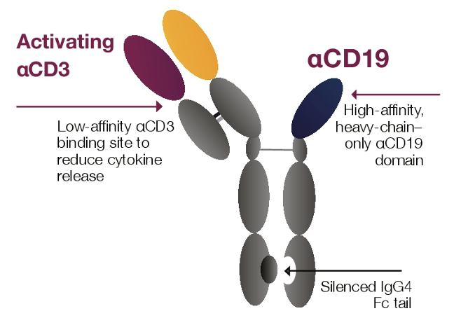
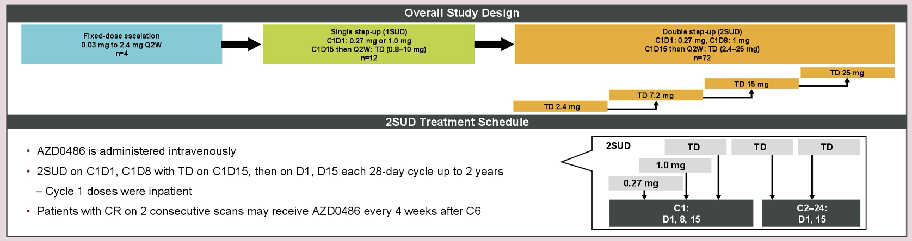
AZD0486: CD19xCD3 T-cell engager – Phase 1 Study
Kim TM et al. ASCO 2025;Abstract 7046.

Slide 75
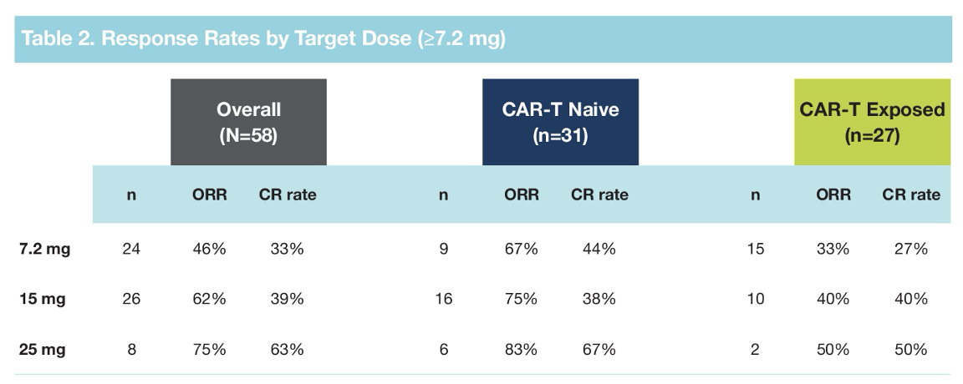
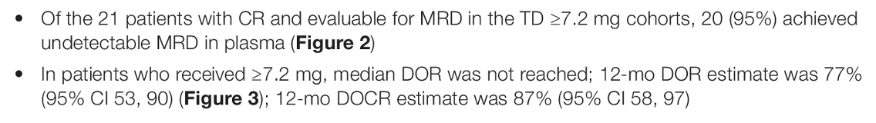
AZD0486: CD19xCD3 T-cell engager – Phase 1 Study
Kim TM et al. ASCO 2025;Abstract 7046.

Slide 76
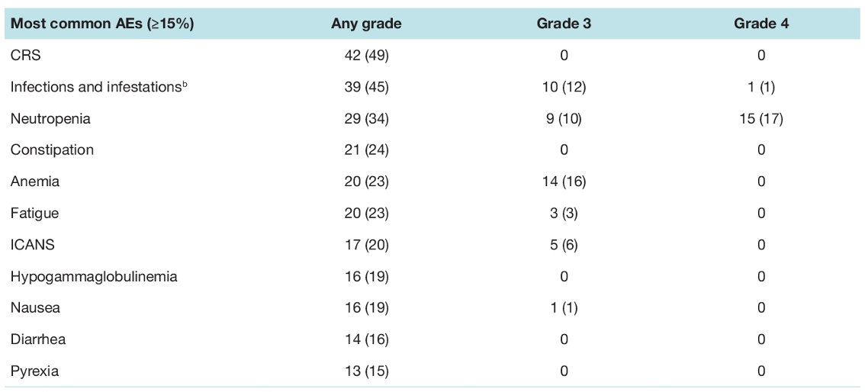
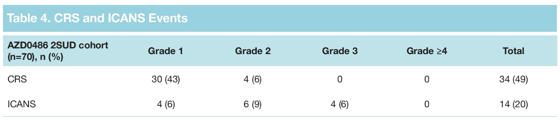
AZD0486: CD19xCD3 T-cell engager – Phase 1 Study
Kim TM et al. ASCO 2025;Abstract 7046.

Slide 77
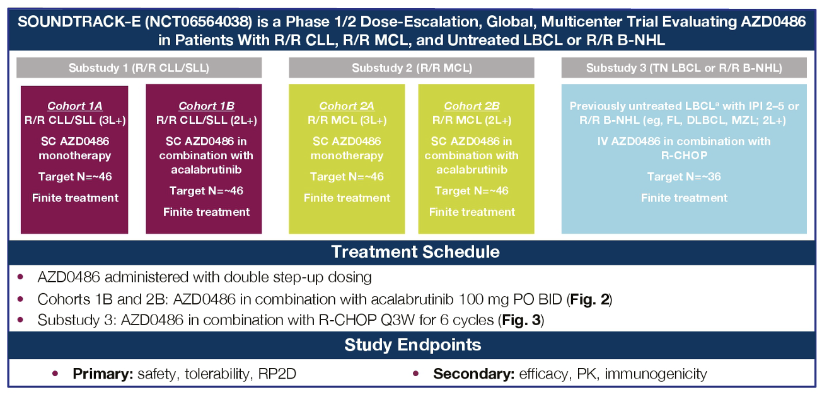
AZD0486: SOUNDTRACK-E Study Design
Eyre TA et al. ASCO 2025;Abstract TPS7083.

Slide 78
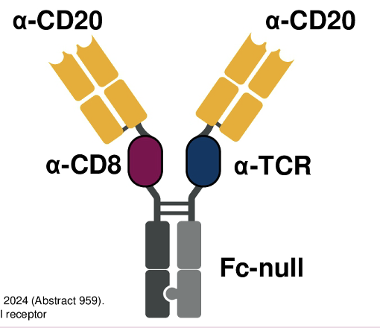
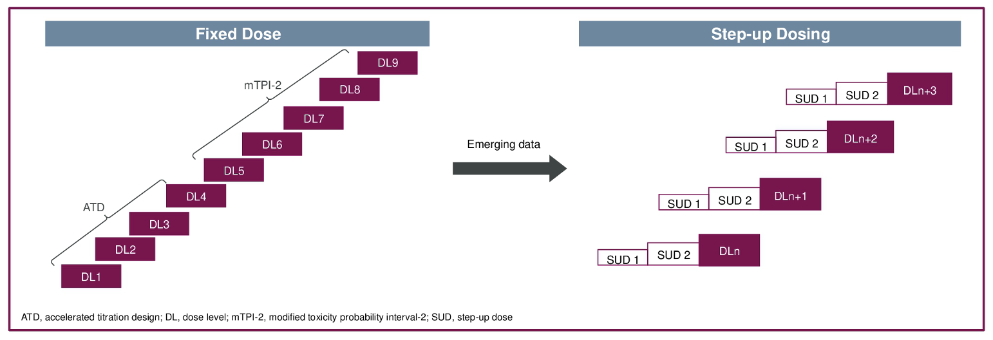
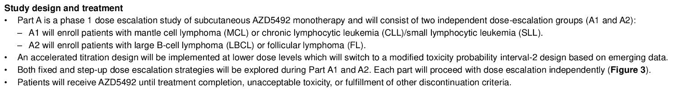
AZD5492: CD8-guided Tri-specific T-cell engager
Shadman M et al. ASCO 2025;Abstract TPS7091.

Slide 79
A patient case
May 2012. 70 yo woman diagnosed with DLBCL. GCB subtype. Stage 3. IPI score 4. Treatment with R-CHOP x 6. Achieves CR.
April 2018. New RP mass. Bx show DLBCL. Now age 76. Receive R-GemOx for 8 cycles. Achieves PR after cycle 4 but has PD by cycle 8.
Nov 2018. Referred to see me. I recommended Axi-Cel CART therapy. No bridging therapy required. Day 30 PET shows CR.
June 2019. New mesenteric mass detected by surveillance imaging. Biopsy shows DLBCL. She receives Lonca-T (on a clinical trial) x 8 cycles. Achieves CR. Therapy stopped due to 3rd spacing.
Feb 2021. New mesenteric mass detected by surveillance imaging. Biopsy shows DLBCL. Offered glofitamab (on a clinical trial) x 12 cycles.

Slide 80
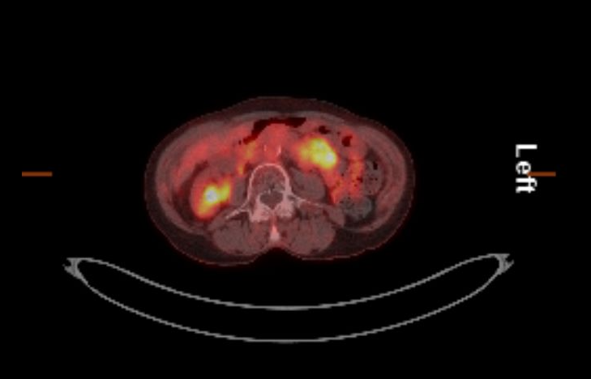
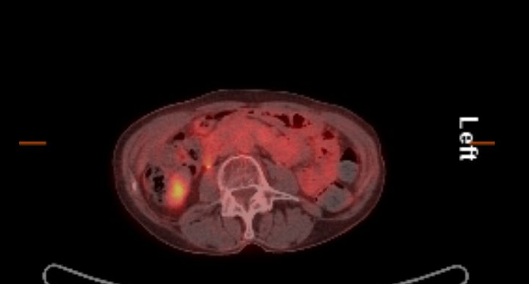
Pre and Post Glofitamab PET images
Feb 2021 PET Scan
AUGUST 2021 PET SCAN

Slide 81
Patient Update
Therapy complicated by hypogammaglobulinemia - on IVIg since 2021
MAI/MAC infection requiring Azithromycin/Rifampin/Ethambutol 2021 - 2022
Chronic neutropenia requiring filgrastim 3X/week 2022 – 2023
RTC August 2025. Now age 82. Patient remains in CR. On IVIg every 6 weeks. Looks fabulous. She and daughter treat themselves to a nice lunch every trip to St. Louis.

Slide 82
Agenda
Faculty Data and Case Presentation – Dr Kahl
• First-line treatment of diffuse large B-cell lymphoma (DLBCL)
• Management of relapsed/refractory DLBCL
Faculty Data and Case Presentation – Dr Casulo
• Follicular lymphoma
• Marginal zone lymphoma
• Mantle cell lymphoma

Slide 83
Overview Discussion
Selection of first-line treatment for
• Low-risk FL
• Standard-risk FL
• Mantle cell lymphoma

Slide 84
The Implications of Recent Data Sets for Current and Future Management of Non-Hodgkin Lymphoma (NHL): Insights from ASCO/EHA/ICML, Highlighting Follicular, Marginal, and Mantle Cell Lymphoma
Carla Casulo, MD Wilmot Cancer Institute, University of Rochester
September 17th, 2025

Slide 85
Relapsed Follicular Lymphoma with POD24
Case 1:
59 year old man with no PMH diagnosed with grade 2-3a FL treated with R-CHOP x 6 cycles; with CR
14 months later, develops fatigue, abdominal pain, inguinal fullness
Laboratory values show hemoglobin 8.9 g/dL, LDH normal
PET shows large mesenteric mass with bilateral pelvic lymphadenopathy, SUV max 6.4
Biopsy reveals classical FL, no signs of transformation

Slide 86
What are new options for 2nd line FL?

Slide 87
EHA 2025; Abstract S230. Trneny M et al.
inMIND: Phase 3, Double-Blind, Placebo-Controlled, International, Multicenter Randomized Study
Key Inclusion Criteria
Age ≥18 years
FL grades 1-3A (or MZL)*
≥1 prior line of therapy, including an anti-CD20 mAb
ECOG PS 0-2
No prior treatment with Len in combination with R
Tafasitamab Arm (Experimental Arm)
Tafasitamab 12 mg/kg iv, 12 cycles (cycles 1-3: qw; cycles 4-12: q2w)
Len 20 mg/day (days 1-21) po for 12 cycles
R 375 mg/m² iv for 5 cycles (cycle 1: qw; cycles 2-5: q4w)
Screening ≤28 days
Randomization 1:1
End of treatment
5-year follow-up
Placebo Arm (Control Arm)
Placebo iv for 12 cycles (cycles 1-3: qw; cycles 4-12: q2w)
Len 20 mg/day (days 1-21) po for 12 cycles
R 375 mg/m² iv for 5 cycles (cycle 1: qw; cycles 2-5: q4w)
Stratification Factors (Patients With FL)
POD24
Refractoriness to prior anti-CD20 mAb therapy
Number of prior lines of therapy (1 or ≥2)
Study Endpoints in FL Population (Investigator Assessed Unless Specified)
Primary study endpoint: PFS
Key secondary: PET-CR rate in the FDG-avid population, OS
Select other secondary: PFS by IRC, ORR, DOR, safety, QoL, MRD
Exploratory: TTNT, B-cell recovery, Ig levels, CD19 expression

Slide 88
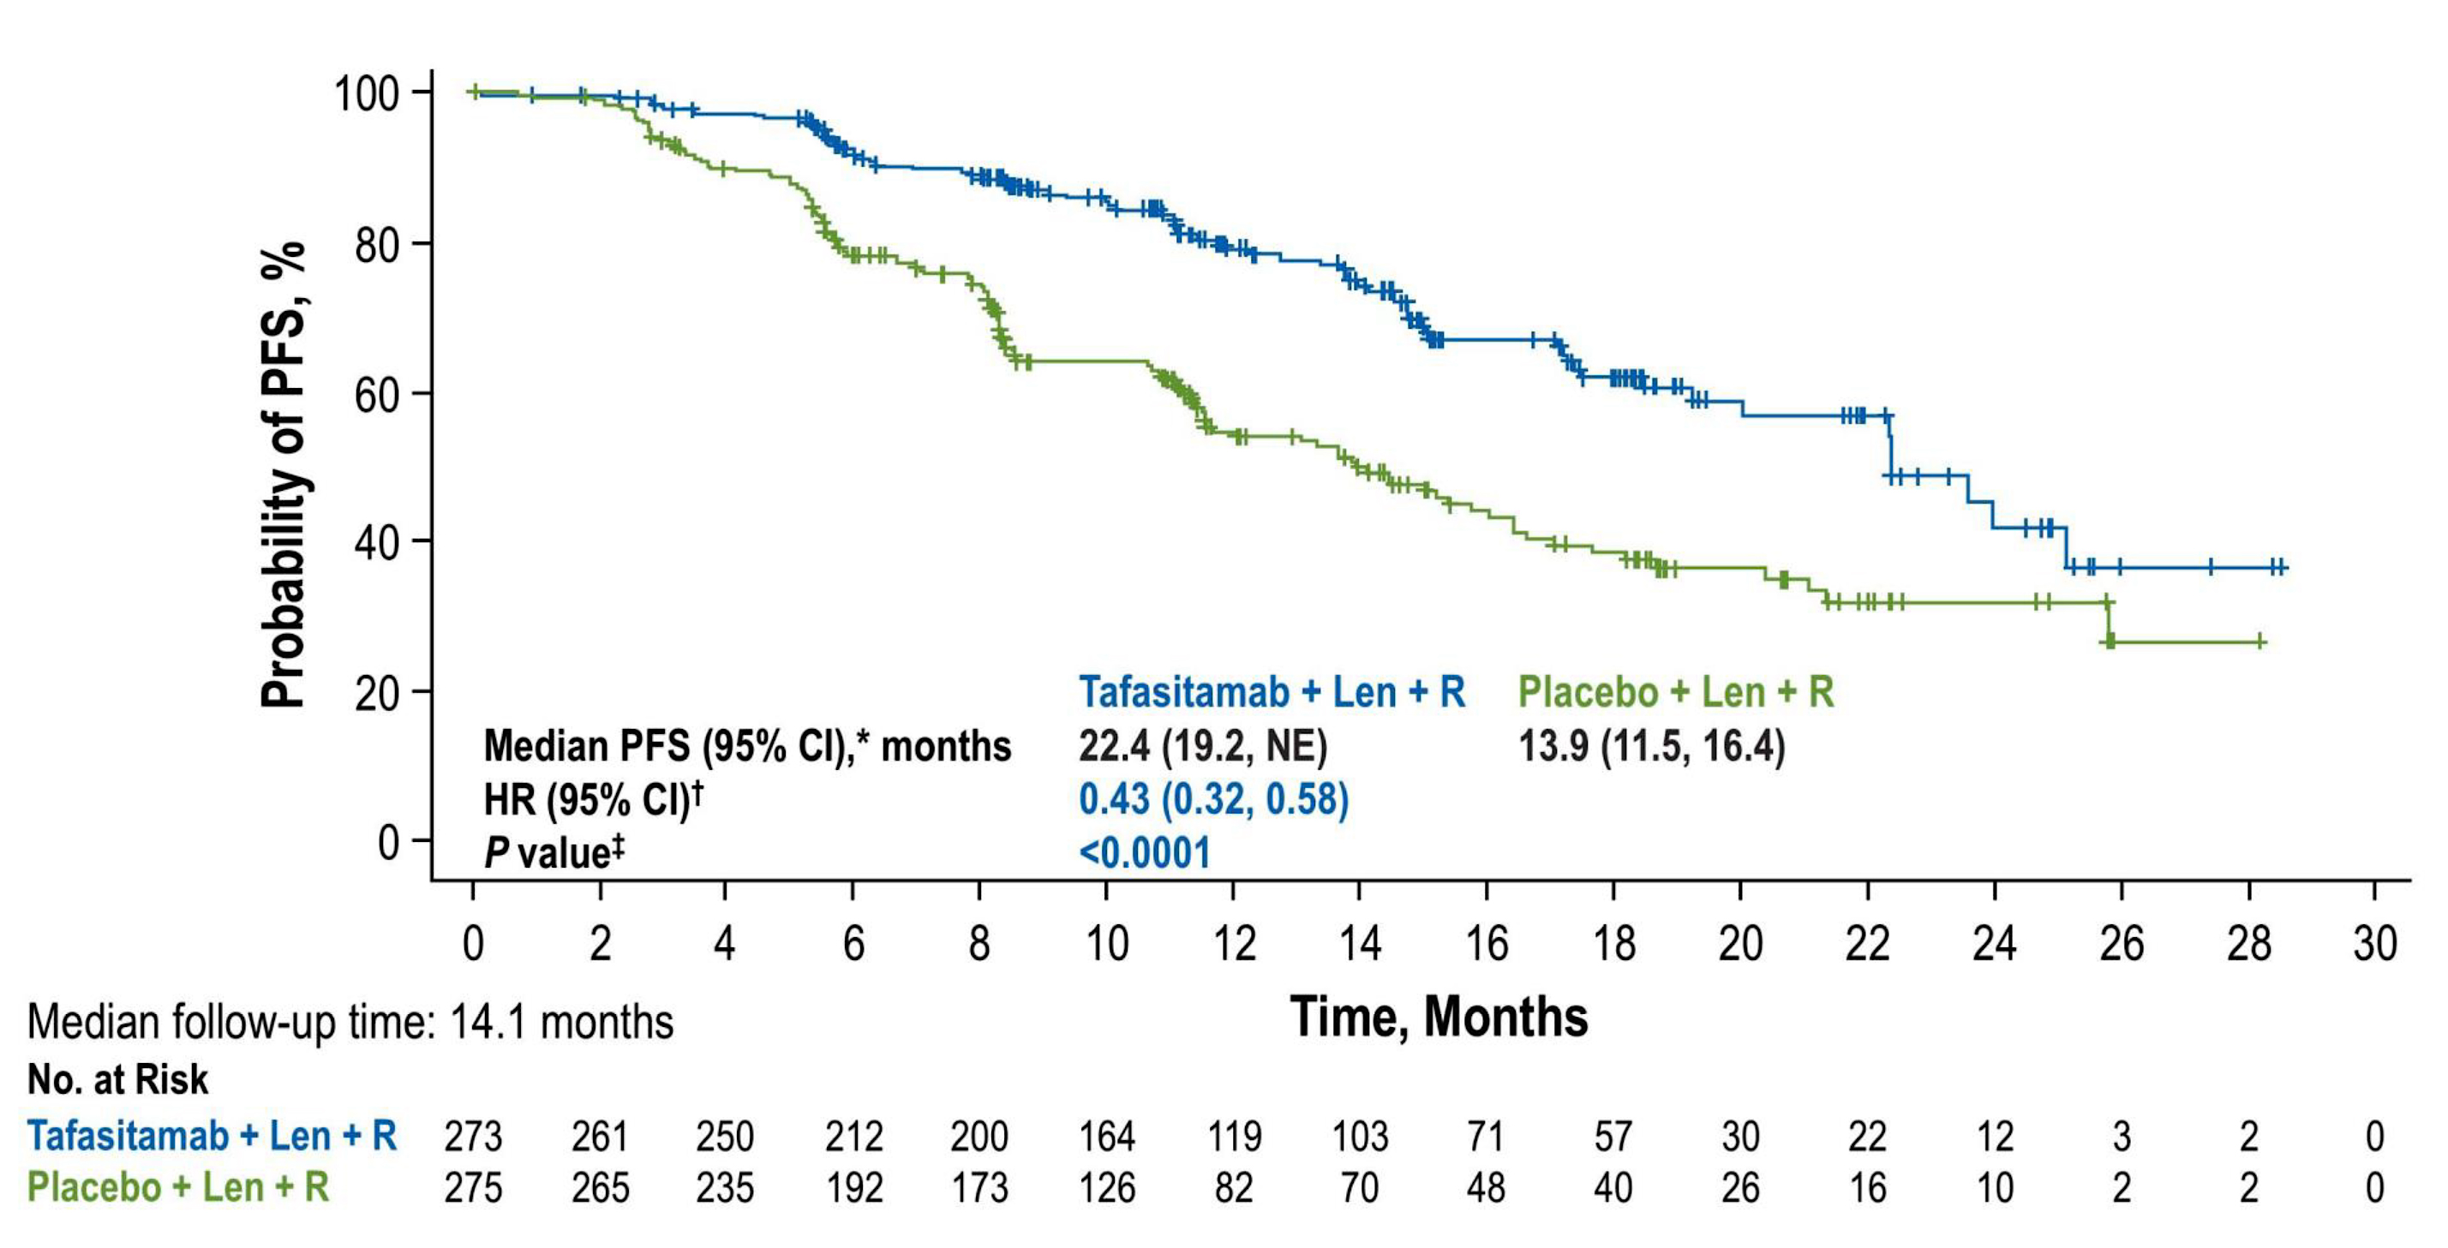
Patient Characteristics, Safety, Efficacy
548 total patients, 273 Tafa/R², 275 Placebo R²
Median PFS | Tafa/R² | Placebo/R²
 | 22.4 months | 13.9 months
Benefit with Tafa/R² confirmed by IRC, observed regardless of POD24 status, refractoriness to prior anti-CD20, number of prior lines
Similar Rates of Treatment Related Adverse Events (TRAE)
Neutropenia most common grade 3/4 AE
Discontinuation in 11% and 7% from AE
Deaths in 6% Tafa/R², 9% placebo arm
5 (2%) vs 17 (6%) from progression
6 (2%) in each arm from fatal AEs
EHA 2025; Abstract S230. Trneny M et al.

Slide 89
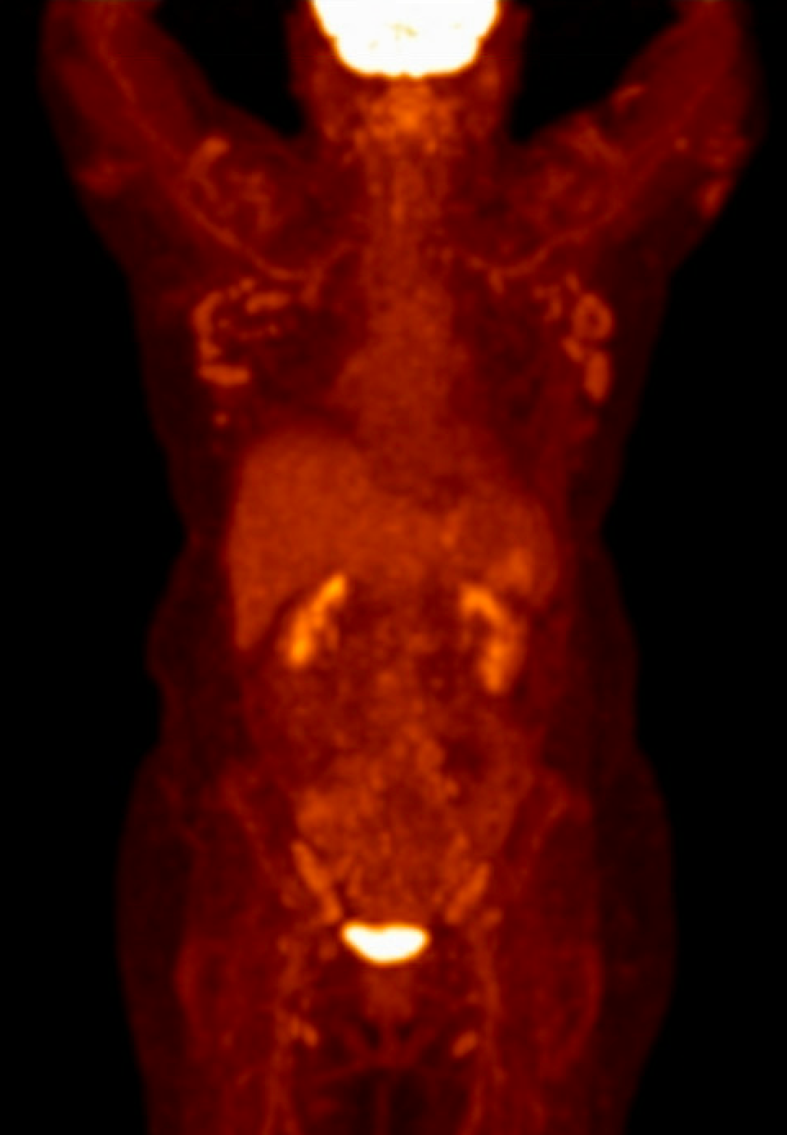
Relapsed Follicular Lymphoma
Case 2:
64 year old woman with past medical history of ER/PR/HER-2 negative breast cancer s/p ACT chemotherapy at age 58 with CR and in remission
Diagnosed with advanced stage high tumor grade 1 FL treated with BR x 6 cycles; with CR
5 years after BR, develops axillary lymphadenopathy and fatigue
Biopsy reveals classical FL
PET shows bilateral prominent axillary, subpectoral nodes with SUV max 6.8
Increase in size and metabolic activity of right external iliac lymph node, concerning for disease progression

Slide 90
Relapsed Follicular Lymphoma
Case 2 continued:
64 year old woman with advanced stage high tumor grade 1 FL treated with BR x 6 cycles; with CR
Past medical history of ER/PR/HER-2 negative breast cancer s/p ACT chemotherapy at age 58 with CR and in remission
5 years after BR, develops axillary lymphadenopathy and fatigue
Biopsy reveals classical FL
Treated with R², complete response
1 year later, develops recurrent classic FL involving bulky disease in lymph nodes (>7 cm), pleural

Slide 91
What are updated options for 3rd line FL?

Slide 92
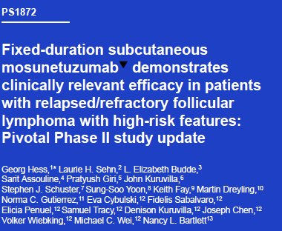
Bispecific Antibody Update at EHA 2025
Mosunetuzumab
Phase 2 dose expansion cohort
94 patients enrolled
47% double refractory, 44% POD24 from start of first-line treatment
30% elevated LDH
23% with bulky disease (>7cm)
EHA 2025; Abstract PS1872. Hess G et al.

Slide 93
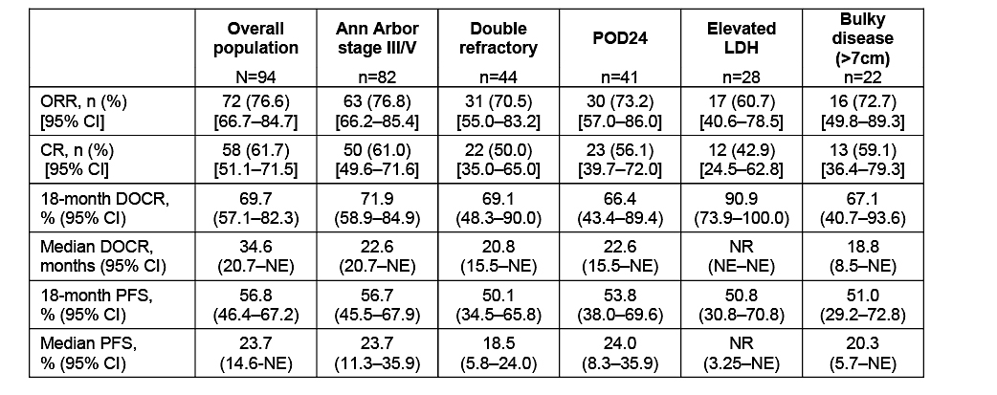
Efficacy Outcomes in Overall and High-Risk Population
EHA 2025; Abstract PS1872. Hess G et al.

Slide 94
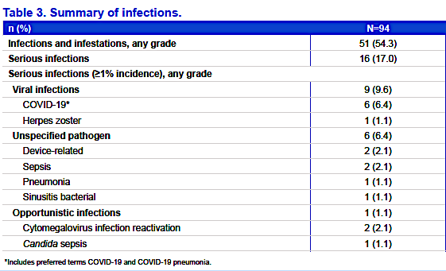
Safety
Infections occurred in > 50% of patients, mostly viral
Grade 5 events (3%) were COVID related
EHA 2025; Abstract PS1872. Hess G et al.
Notes:
Serious infections in 17%
Same pharmacokinetics as IV

Slide 95
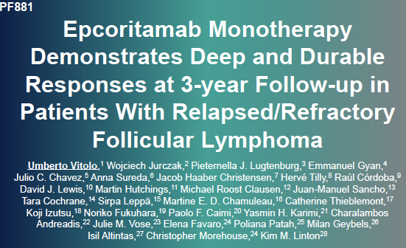
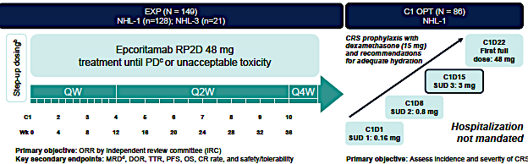
Epcoritamab
3-year follow up from 2 pooled cohorts (N=149) and C1 optimization group (N=86)
Exploratory outcomes in patients stopping early in CR
EHA 2025; Abstract PF881; Vitolo U et al.
Notes:
The C1 opt as introduced to reduce the risk of CRS

Slide 96
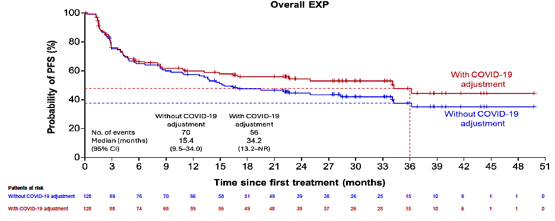
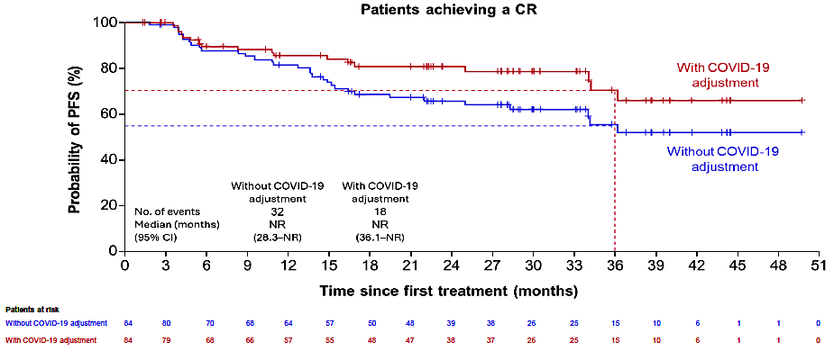
Updated Outcomes with Epcoritamab
35 patients discontinued treatment in CR without PD/death: 16 from AE, 9 patient decision
94% (33/35) had sustained CR on subsequent scan
Median time in CR after treatment discontinuation: 13 months (2 patients had PD)
EHA 2025; Abstract PF881; Vitolo U et al.

Slide 97
Updates to EPCORE FL-1 Study
Phase 3 EPCORE® FL-1 Clinical Trial Meets Dual Primary Endpoints in Patients with Relapsed/Refractory Follicular Lymphoma
https://ir.genmab.com/news-releases/news-release-details/genmab-announces-phase-3-epcorer-fl-1-clinical-trial-met-dual

Slide 98
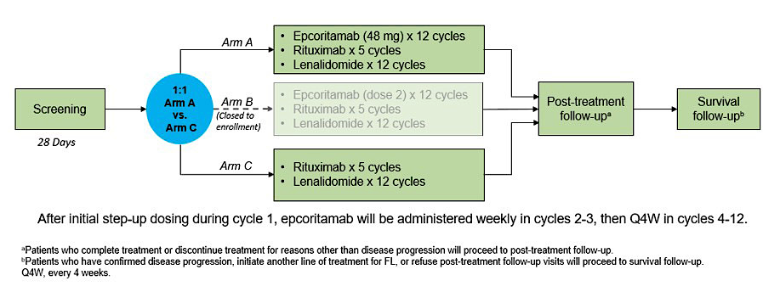
A Phase 3, Open-Label Study to Evaluate Safety and Efficacy of Epcoritamab in Combination With Rituximab and Lenalidomide (R²) Compared to R² in Subjects With Relapsed or Refractory Follicular Lymphoma (EPCORE FL-1)
NCT05409066
Key Inclusion Criteria
2L+ FL ≥1 prior treatment including an anti-CD20 mAb in combination with chemotherapy (not refractory to lenalidomide; no lenalidomide within 12 months)
Histologically confirmed CD20+
Grade 1-3a, Stage II-IV
ECOG PS 0-2
Primary Endpoints: BOR (CR or PR) per Lugano by IRC, PFS per Lugano by IRC
ASH 2023; Abstract 3053; Falchi L et al.

Slide 99
Phase 2 ELARA Trial 4-year Update: Clinical Outcomes of Tisagenlecleucel in Patients With High-Risk Relapsed/Refractory Follicular Lymphoma
Catherine Thieblemont, MD¹; Martin Dreyling, MD²; Michael J. Dickinson, MBBS, D Med Sci, FRACP, FRCPA³; Joaquin Martinez-Lopez, MD, PhD⁴; Arne Kolstad, MD, PhD⁵; Jason Butler, MBBS⁶; Monalisa Ghosh, MD⁷; Leslie L. Popplewell, MD, FACP, MPH⁸; Julio C. Chavez, MD⁹; Emmanuel Bachy, MD, PhD¹⁰; Koji Kato, MD, PhD¹¹; Hideo Harigae, MD, PhD¹²; Marie José Kersten, MD, PhD¹³; Charalambos Andreadis, MD, MS¹⁴; Peter A. Riedell, MD¹⁵; P. Joy Ho, MBBS, FRACP, FRCPA¹⁶; Jose Antonio Pérez Simon, MD, PhD¹⁷; Andy Chen, MD, PhD¹⁸; Loretta J. Nastoupil, MD¹⁹; Bastian von Tresckow, MD^{20, 21}; Andrés José María Ferreri, MD²²; Takanori Teshima, MD, PhD²³; Piers E.M. Patten, MBChB, FRCP, FRCPath, PhD²⁴; Joseph P. McGuirk, DO²⁵; Fritz Offner, MD, PhD²⁶; Andreas Viardot, MD, PhD²⁷; Pier Luigi Zinzani, MD, PhD^{28, 29}; Ram Malladi, MD, PhD³⁰; Aiesha Zia, MSc³¹; Rakesh Awasthi, PhD³²; Davide Germano, PhD³³; Roberto Javier Ramos, MD³²; Pei Hsu, MD³¹; Stephen J. Schuster, MD³⁴; Nathan H. Fowler, MD³⁵
EHA 2025;Abstract PS2150

Slide 100
ELARA Study Design
Screening, apheresis, and cryopreservation
(N=122)
Optional bridging chemotherapyª
First efficacy assessment
Month 3 (N=94)
Median follow-up:
53 months (Range 46-62)
Tisagenlecleucel manufacturing
Enrollment (N=98)
Restaging, lymphodepletion
Tisagenlecleucel infusion^{b} (N=97)
Long-term safety and efficacy follow-up^{c}
Key eligibility criteria | Study treatment | End points
≥18 years of age FL grade 1, 2, or 3A Relapsed/refractory disease^{d} No evidence of histological transformation/FL3B No prior anti-CD19 therapy or allogeneic HSCT | Tisagenlecleucel dose range (single IV infusion) was 0.6-6×10⁸ CAR-positive viable T cells | Primary: CRR by IRC Secondary: ORR, DOR, PFS, OS, safety, cellular kinetics
Bridging therapy was allowed and was followed by disease re-evaluation before tisagenlecleucel infusion
Cellular kinetics were determined by measurement of transgene levels by qPCR
MRD levels were determined via clonoSEQ® next-generation sequencing assay performed at Adaptive Biotechnologies (Seattle, WA, USA)
EHA 2025; Abstract PS2150; Thieblemont C et al.

Slide 101

Durable and High Responses Reported
Key patient subgroups at high risk (N = 94):
Disease refractory to ≥2 prior regimens: 72%
Bulky disease (>7 cm or at least 3 lesions >3 cm): 66%
POD24 from first anti-CD20 mAb-containing therapy: 65%
High FLIPI (≥3): 61%
High tumor burden (TMTV >510 mL^{1,2}): 21%
Kaplan-Meier medians
CR: 53.3 months; 95% CI: NE-NE
PR: 5.9 months; 95% CI: 3.7-6.2
All patients: 53.3 months; 95% CI: 18.2-NE
 | 48-mo PFS, %
In all patients In patients with BOR of CR | 50.2 66.1
High response rate reported anytime post-infusion (CR: 69.1%)
EHA 2025; Abstract PS2150; Thieblemont C et al.

Slide 102
Durable and High Responses Reported in Patients With High-risk Disease Characteristics
POD24
High FLIPI
120
120
105
48-mo PFS: 45.5%
105
48-mo PFS: 45.5%
90
Censoring Times
POD24 Yes (N=61)
POD24 No (N=33)
Number of Events (n)
POD24 Yes : 31
POD24 No : 13
Kaplan-Meier medians
POD24 Yes : 30.8 months, 95 % Cl [9.5. NE]
POD24 No : NE months, 95 % Cl [18.4 NE]
90
Censoring Times
FLIPI High (N= 57)
FLIPI Low/lntermediate (N=37)
Number of Events (n)
FLIPI High : 28
FLIPI Low/lntermediate : 16
Kaplan-Meier medians
FLIPI High : 30.0 months, 95 % Cl [12.3, NE]
FLIPI Low/lntermediate : NE months, 95 0/0 Cl [23.5, NE]
75
75
Probability (%) of event free
Probability (%) of event free
60
60
45
45
30
30
15
15
0
0
3
6
9
12
15
18
21
24
27
30
33
36
39
42
45
48
51
54
0
0
3
6
9
12
15
18
21
24
27
30
33
36
39
42
45
48
51
54
Number of patients still at risk
Time (months)
Number of patients still at risk
Time (months)
POD24 Yes
61
50
40
36
33
30
29
29
28
28
28
26
24
20
19
18
9
2
0
FLIPI High
57
46
38
33
31
29
27
25
24
24
22
22
20
18
17
17
7
1
0
POD24 No
33
30
27
26
24
24
23
21
20
20
18
18
17
16
16
16
6
0
0
FLIPI Low/lntermediate
37
34
29
29
26
25
25
25
24
24
24
22
21
18
18
17
8
1
0
Bulky disease
Double refractory
120
120
105
48-mo PFS: 45.2%
105
48-mo PFS: 52.8%
90
Censoring Times
Bulky disease Yes (N= 62)
Bulky disease No (N= 32)
Number of Events (n)
Bulky disease Yes : 32
Bulky disease No : 12
Kaplan-Meier medians
Bulky disease Yes 30.0 months, 95 % Cl [12.1 , NE]
Bulky disease No : NE months, 95 0/0 Cl [23.5, NE]
90
75
75
Censoring Times
Double refractory Yes (N= 65)
Double refractory No (N= 29)
Number of Events (n)
Double refractory Yes: 29
Double refractory No: 15
Kaplan-Meier medians
Double refractory Yes: 53.3 months, 95 % CI [17.8, NE] Double refractory No: 29.5 months, 95 % CI [9.1, NE]
60
60
Probability (%) of event free
Probability (%) of event free
45
45
30
30
15
15
0
0
3
6
9
12
15
18
21
24
27
30
33
36
39
42
45
48
51
54
0
0
3
6
9
12
15
18
21
24
27
30
33
36
39
42
45
48
51
54
Number of patients still at risk
Time (months)
Number of patients still at risk
Time (months)
Bulky disease Yes
62
53
43
38
35
32
30
29
28
28
26
25
23
21
20
19
7
1
0
Double refractory Yes
65
55
48
43
40
38
36
35
34
34
33
31
29
25
24
23
11
2
0
Bulky disease No
32
27
24
24
22
22
22
21
20
20
20
19
18
15
15
15
8
0
0
Double refractory No
29
25
19
19
17
16
16
15
14
14
13
13
12
11
11
11
4
0
0
EHA 2025; Abstract PS2150; Thieblemont C et al.

Slide 103
Lisocabtagene maraleucel in relapsed or refractory follicular lymphoma (TRANSCEND FL): impact of prior lines of therapy, bendamustine exposure, and disease progression ≤ 24 months of initial systemic therapy
What is the Impact of Prior Bendamustine Exposure and POD24 on Treatment Efficacy?
Sairah Ahmed,¹ Juan Luis Reguera Ortega,² Franck Morschhauser,³ Guillaume Cartron,⁴
Aaron P. Rapoport,⁵ Koji Izutsu,⁶ Hervé Ghesquieres,⁷ M. Lia Palomba,⁸ Hideki Goto,⁹
John Kuruvilla,¹⁰ Jeremy S. Abramson,¹¹ Peter Borchmann,¹² Ulrich Jäger,¹³ Manali Kamdar,¹⁴
Merav Bar,¹⁵ Maria Strocchia,¹⁶ Martina Raggi,¹⁶ Rina Nishii,¹⁷ Alejandro Martín García-Sancho¹⁸
Post hoc analyses of efficacy and safety outcomes in patients with R/R FL from TRANSCEND FL by number of prior LOTs, POD24 status from first-line therapy with anti-CD20 antibody/alkylator, and prior bendamustine exposure before leukapheresis
ICML 2025, Presentation 142

Slide 104
ORR and CR Rates Across Subgroups
TRANSCEND FL
Number of prior LOTs
POD24 (2L+)
Prior bendamustine exposure before leukapheresis (2L+)
96%
(n = 22)
98%
(n = 47)
96%
(n = 53)
96%
(n = 68)
98%
(n = 53)
97%
(n = 57)
100%
(n = 8)
100%
(n = 11)
96%
(n = 46)
Responders, %
CR rate,
96%
(n = 22)
CR rate,
96%
(n = 46)
CR rate,
93%
(n = 51)
CR rate,
94%
(n = 67)
CR rate,
94%
(n = 51)
CR rate,
95%
(n = 56)
CR rate,
75%
(n = 6)
CR rate,
100%
(n = 11)
CR rate,
96%
(n = 46)
ORR was 96%—100% across all subgroups
Ahmed S, et al. ICML 2025 [Abstract #142]
Notes:
104

Slide 105
Time-to-event Outcomes Generally High Across Subgroups
 | Number of prior LOTs |  |  | POD24 (2L+)ª |  | Prior bendamustine exposure before leukapheresis (2L+) |  |  |  | Total 2L+ population (N = 126)
 | 2L (n = 23) | 3L (n = 48) | 4L+ (n = 55) | Yes (n = 71) | No (n = 54) | None (n = 59) | < 12 mo (n = 8) | 12—24 mo (n = 11) | > 24 mo (n = 48)
Median DOR, months^{b} | NR | NR | 30.9 | 30.9 | NR | NR | NR | NR | NR | NR
24-month DOR rate, % | 86 | 76 | 73 | 70 | 87 | 77 | 50 | 72 | 82 | 77
Median (95% CI) PFS, months^{b} | NR | NR | 31.8 | 31.8 | NR | 31.8 | NR | NR | NR | NR
24-month PFS rate, % | 83 | 75 | 71 | 67 | 85 | 74 | 50 | 72 | 79 | 74
24-month OS rate, % | 96 | 89 | 87 | 86 | 94 | 93 | 71 | 91 | 88 | 90
Free of next treatment at 24-month rate, % | 91 | 85 | 76 | 78 | 89 | 85 | 58 | 91 | 81 | 82
A trend toward better outcomes was observed with liso-cel in earlier versus later (4L+) LOTs
24-month rates generally better for patients without POD24 but clinically meaningful in patients with POD24
Outcomes consistently high for all prior bendamustine subgroups except for the < 12-month subgroup where trend for lower 24-month rates observed; interpretation with caution due to small sample size (n = 8)
Ahmed S, et al. ICML 2025 [Abstract #142]

Slide 106
First line Follicular Lymphoma
Case 3:
Patient is a 71 year old man with a history of prostate cancer s/p prostatectomy and nephrolithiasis
He develops cervical lymphadenopathy, undergoes excisional biopsy showing classical follicular lymphoma
He feels well and is minimally symptomatic except for mild back pain
PET shows advanced stage high tumor burden disease with retroperitoneal lymphadenopathy complicated by ureteral compression and hydronephrosis
Laboratory tests show mild renal insufficiency (creatinine 1.76 mg/dL)

Slide 107
What are new studies in 1st line FL?

Slide 108

Flinn et al. ASCO 2025;Abstract 7014.

Slide 109

Flinn et al. ASCO 2025;Abstract 7014.

Slide 110



Safety and Efficacy
Flinn et al. ASCO 2025;Abstract 7014.

Slide 111
Summary of Updates in FL
Follicular Lymphoma
Front line: Mosunetuzumab in 1st line FL
Relapsed:
inMIND study
Tisa-cel in high risk FL
Liso-cel in Benda-exposed cohorts and POD24
Subcutaneous Mosun
Epcor update
EPCORE-FL1 update

Slide 112
First Line Marginal Zone Lymphoma
52 year old man with history of hypertension underwent an MRI of the spine to evaluate back pain and fatigue
Found to have retroperitoneal lymphadenopathy, 2.8 - 4.2 cm
CT chest, abdomen and pelvis showed mesenteric lymphadenopathy along aortic bifurcation, inguinal region
Lymph node biopsy showed marginal zone lymphoma, laboratory tests showed Hgb 10.7, otherwise normal
Bone marrow biopsy shows low level lymphoma involvement

Slide 113
What are new studies in 1st line MZL?

Slide 114
MorningSun: Open-label Phase II trial of the efficacy and safety of subcutaneous mosunetuzumab (Mosun SC) as frontline (1L) treatment in symptomatic patients with marginal zone lymphoma (MZL)
John M. Burke,¹ Aung M. Tun,² Jose Villasboas,³ L. Elizabeth Budde,⁴ Mitul Gandhi,⁵ Tara Graff,⁶ Prachi Jani,⁷ Juliana M. L. Biondo,⁷ Mei Wu,⁷ Rona Farighi,⁷ Yong Mun,⁷ Tony Lin,⁷ Javier Munoz,⁸ Ian Flinn⁹
¹Rocky Mountain Cancer Centers, Aurora, CO, USA; ²University of Kansas Cancer Center, Kansas City, KS, USA; ³Mayo Clinic, Rochester, MN, USA; ⁴City of Hope National Medical Center, Duarte, CA, USA; ⁵Virginia Cancer Specialists, Gainesville, VA, USA; ⁶Mission Cancer and Blood, Des Moines, IA, USA; ⁷Genentech, Inc., South San Francisco, CA, USA; ⁸Mayo Clinic, Phoenix, AZ, USA; ⁹Tennessee Oncology/OneOncology, Nashville, TN, USA.
EHA 2025;Abstract S232
Notes:
On behalf of my coinvestigators, I am honored to present the results of the MorningSun marginal zone lymphoma cohort. I’d like to thank the organizers of EHA for accepting our abstract.

Slide 115
MorningSun study design: 1L MZL cohort
Key inclusion criteria
Mosunetuzumab SC administration
Symptomatic MZL (splenic, nodal, and extranodal, including gastric/MALT)
Previously untreated, with an indication to start systemic therapy
ECOG performance status 0–2
D8: 45mg
D15: 45mg
D1: 45mg
D1: 45mg
CRS mitigation
Patients were treated for up to 17 cycles unless disease progression or unacceptable toxicity occurred
Mosunetuzumab SC step-up dosing in C1
Corticosteroid prophylaxis* was mandatory in C1–2 and optional thereafter
Hospitalization was not mandatory
D1: 5mg
C1
C2
C3‒17
Endpoints
Primary: INV-assessed ORR by Lugano criteria
Key secondary: PFS, DOR, DOCR, time to response, safety
21-day cycles
EHA 2025; Abstract S232; Burke J et al.
Notes:
Here is the trial design in the marginal zone cohort. Patients were eligible if they were previously untreated, required therapy, and had an ECOG performance status of 0-2. The step-up dosing scheme used is shown to the right and consisted of 5 mg on day 1 of cycle 1, 45 mg on days 8 and 15 of cycle 1, and 45 mg on day 1 of cycles 2-17. Cycles were 21 days long. All patients received either dexamethasone 20 mg or methylprednisolone 80 mg prior to each dose in cycles 1-2. Acetaminophen and diphenhydramine were optional. Hospitalization was not required. The primary endpoint of the study was overall response rate by Lugano criteria. Secondary endpoints included progression-free survival, duration of response, time to response, and safety.

Slide 116

Population and Outcomes
n (%), unless stated | N=36
Median age, years (range) | 69 (36–81)
Female | 24 (66.7)
Race*
White | 32 (88.9)
Black or African American | 1 (2.8)
Extranodal involvement | 28 (77.8)
Bulky disease | 7 (19.4)
ECOG performance status
0 | 20 (55.6)
1 | 13 (36.1)
2 | 3 (8.3)
EHA 2025; Abstract S232; Burke J et al.
Notes:
Here are the best response rates achieved by patients at any time on the study. As shown in the left-most column, the overall response rate was 78%, complete response rate 64%, and partial response rate 14%. The rest of the bar graphs look at response rates based on the risk factors of LDH, extranodal involvement, age, and stage. In general CR rates in high-risk subgroups were similar to those of the overall population.
Subgroup Analysis of ORR seen amongst the MZL subtypes:
Extranodal:
ORR: 13/14 (92.9%)
CR: 11/14 (78.6%)
PR: 2/14 (14.3%)
SD: 0
PD: 0
Missing: 1/14 (7.1%)
Nodal:
ORR: 11/17 (64.7%)
CR: 8/17 (47.1%)
PR: 3/17 (17.6%)
SD: 2/17 (11.8%)
PD: 2/17 (11.8%)
Missing: 2/17 (11.8%)
Splenic:
ORR: 3/4 (75.0%)
CR: 3/4 (75.0%)
PR: 0
SD: 0
PD: 0
Missing: 1/4 (25.0%)
Unknown:
ORR: 1/1 (100.0%)
CR: 1/1 (100.0%)
PR: 0
SD: 0
PD: 0
Missing: 0

Slide 117

Safety and Efficacy
Progression Free Survival
n (%) | N=36
Any grade AE | 36 (100)
Grade 3/4 AEs | 23 (63.9)
Most common Grade 3/4 AEs (≥10%)
Neutropenia/neutrophil count decreased | 10 (27.8)
Anemia | 4 (11.1)
Grade 5 AEs | 0
Select AEs of interest
ICANS | 0
Serious AEs* | 14 (38.9)
AE leading to mosunetuzumab discontinuation† | 6 (16.7)
EHA 2025; Abstract S232; Burke J et al.

Slide 118
Relapsed Marginal Zone Lymphoma
52 year old man with history of hypertension underwent an MRI of the spine to evaluate back pain and fatigue
Found to have retroperitoneal lymphadenopathy, 2.8 - 4.2 cm
CT chest, abdomen and pelvis showed mesenteric lymphadenopathy along aortic bifurcation, inguinal region
Lymph node biopsy showed marginal zone lymphoma, laboratory tests showed Hgb 10.7, otherwise normal
Bone marrow biopsy shows low level lymphoma involvement
Patient is treated with BR x 6 cycles with PR → observation
3 years later develops recurrent MZL with axillary, mesenteric, and inguinal lymphadenopathy, treated with BTKi → 18 months later progression

Slide 119
What are new studies in relapsed MZL?

Slide 120
Lisocabtagene maraleucel in patients with relapsed or refractory marginal zone lymphoma in the phase 2 TRANSCEND FL study
M. Lia Palomba,¹ Stephen J. Schuster,² Reem Karmali,³ Alan P. Skarbnik,⁴ Jeremy S. Abramson,⁵ Kirit Ardeshna,⁶ Peter Borchmann,⁷ Brian T. Hill,⁸ Alejandro Martin Garcia-Sancho,⁹ Antonio Pinto,¹⁰ Aaron P. Rapoport,¹¹ Guillaume Cartron,¹² Isabelle Fleury,¹³ Koji Izutsu,¹⁴ Manali Kamdar,¹⁵ Stephan Mielke,¹⁶ Anna Maria Barbui,¹⁷ Juan Luis Reguera Ortega,¹⁸ Loretta J. Nastoupil,¹⁹ Sairah Ahmed,²⁰ Merav Bar,²¹ Lizbeth Diaz,²² Victoria Diab,²³ Min Vedal,²² Silvia Colicino,²² Ariel Avilion,²¹ Rina Nishii,²³ Franck Morschhauser²⁴
ICML 2025, Presentation 055

Slide 121





TRANSCEND FL study design: MZL cohort
Key MZL eligibility criteria
Age ≥ 18 years
MZL histologically confirmed ≤ 6 months before screening as assessed by local pathology
R/R MZL (measurable disease) after ≥ 2 prior lines of systemic therapy, including ≥ 1 line of combination systemic therapy, therapy with an anti-CD20 antibody and an alkylating agent, or had relapsed disease after HSCT
ECOG PS ≤ 1
Adequate bone marrow, kidney, liver, and cardiac function
CT-positive
disease reconfirmed
Leukapheresis
Day 1
Day 29
Follow-up
Liso-cel
manufacturing
Lymphodepletion
On-study: 5 years
Long-term (NCT03435796): up to 15 years after liso-cel infusion
FLU 30 mg/m² and
CY 300 mg/m² × 3 days
Liso-cel
100 × 10⁶ CAR⁺ T cells
(2—7 days after LDC)
First disease assessment
Screening
Bridging therapy allowed
Primary endpoint
ORR (BOR of CR or PR) per IRC by CT using Lugano 2014 criteria¹ in the efficacy-evaluable set
Secondary endpoints
CR rate, DOR, DOR if BOR is CR, and PFS per IRC by CT using Lugano 2014 criteria¹ in the efficacy-evaluable set; OS; safety; and cellular kinetics
Exploratory endpoints
B-cell aplasia
Study endpoints of ORR and CR rate were tested hierarchically in the following order at 1‑sided α = 0.025 significance: ORR (H₀: ORR ≤ 50%) and then CR rate (H₀: CR rate ≤ 5%)
121
Palomba ML, et al. ICML 2025 [Abstract #055]

Slide 122
ORR and CR rate per CT assessed by IRC
 | Liso-cel—treated set (n = 67)
Median (range) age, y | 62 (37—81)
< 65 y | 37 (55)
≥ 65 y to < 75 y | 20 (30)
≥ 75 y | 10 (15)
Male, n (%) | 39 (58)
MZL subtype, n (%)
Nodal | 32 (48)
Splenic | 18 (27)
Extranodal/Mucosa-associated lymphoid tissue | 17 (25)
Efficacy-evaluable set (n = 66)
ORRª | CR rateª
95.5% (95% CI,ª 87.3—99.1) P < 0.0001^{b} | 62.1% (95% CI,ª 49.3—73.8) P < 0.0001^{b}
62.1%
n = 98
n = 95
117 (94%)
33.3%
The primary endpoint of ORR and secondary endpoint of CR rate per CT assessed by IRC were met
Among patients with PET-positive disease at baseline (n = 56), ORR was 98.2%^{c} and CR rate was 91.1%^{c}
1.5%
n = 1
1.5%
n = 1
1.5%
n = 1
n = 41
n = 22
Palomba ML, et al. ICML 2025 [Abstract #055]
Notes:
122

Slide 123
Progression Free Survival
Median (95% CI):
NR (34.8 months—NR)
100
90
80
70
60
Median PFS | 24-month PFS
NR (95% CI, 34.8 months—NR) | 85.7% (95% CI, 72.2—92.9)
Median PFS in CR | 24-month PFS in CR
NR (95% CI, 34.8—NR) | 90.1% (95% CI, 70.3—96.9)
Median PFS in PR | 24-month PFS in PR
NR (95% CI, 26.4—NR) | 90.2% (95% CI, 65.9—97.5)
50
PFS per IRC, %
40
30
20
10
Median follow-up: 23.8 months (95% CI, 19.4—24.1)
0
0
3
6
9
12
15
18
21
24
27
30
33
36
39
Time from liso-cel infusion, months
No. at risk
3L+ MZL
66
63
61
61
59
51
45
37
23
12
10
10
3
0
Palomba ML, et al. ICML 2025 [Abstract #055]

Slide 124
Summary of Updates in MZL
Marginal Zone Lymphoma
Front line: Mosunetuzumab in 1st line MZL
Relapsed: Liso-cel in relapsed MZL

Slide 125
First Line Mantle Cell Lymphoma
65 year old man with no past history develops tonsillar enlargement and pharyngitis
Receives treatment with several antibiotics, no improvement
Undergoes a tonsillar biopsy showing mantle cell lymphoma. Ki-67 index is 40%, MIPI is intermediate risk
NGS testing shows no mutations in TP53
PET shows widespread lymphadenopathy, and bilateral tonsillar enlargement and uptake. Bone marrow biopsy shows involvement of mantle cell lymphoma
Patient begins treatment with Acalabrutinib, Bendamustine and Rituximab

Slide 126
What are new updates in 1st line MCL?

Slide 127

EHA 2025; Abstract S233; Dreyling M et al.

Slide 128

100
80
60
Patients, %
40
20
0
EHA 2025; Abstract S233; Dreyling M et al.

Slide 129

EHA 2025; Abstract S233; Dreyling M et al.
Notes:
There was also the ENRICH study [investigating] skipping chemotherapy overall and only testing a BTK inhibitor plus rituximab [in older patients with previously treated MCL]. That trial showed that in patients with a low-risk profile, skipping chemotherapy and moving on to, in this case ibrutinib plus rituximab, was superior to using SOC chemotherapy. One pill a day is better than what we used to do during the past decades, which was applying efficient but toxic chemotherapy. That was the starting point [that made us consider]: What about the high-risk patients in the ECHO trial?
For the high-risk patients in the ENRICH trial, [the addition of] chemotherapy was [more effective] than a BTK inhibitor [plus rituximab alone]. Therefore, the logical consequence was to combine both and test BR plus acalabrutinib in high-risk patients. Importantly, high risk [means] biological high risk, either blastoid variant disease, a Ki-67 score above 30%, or a TP53 mutation. If we apply these criteria, 1 of those risk factors is enough to make a patient high risk.
The ECHO regimen of chemotherapy plus a BTK inhibitor has greater benefits in the high-risk patients. Regarding the CR rate, it was [66.6]% in the overall group and [67.9]% in the high-risk group. That also translates into a PFS benefit for the overall group.
For example, if you also consider the single risk factors like blastoid morphology and look at the benefit in PFS…the HR was 0.59—a more pronounced benefit compared with 0.73 in the overall group. The same also holds up for patients with a Ki-67 score of at least 50%, with an HR of 0.69. The PFS curves split further apart. For the high-risk group, chemotherapy [alone] is not enough, which we knew before, but now we have confirmation in a randomized trial. Unfortunately, the data [for patients with TP53 mutations are too small of a sample], so we cannot make a comment on that [subgroup].

Slide 130

EHA 2025; Abstract PF882; Wang M et al.
Notes:
In the phase 3 ECHO trial, achieving MRD negativity was associated with improved PFS. MRD was a stronger prognostic factor for outcome than clinical response. Continuous therapy with acalabrutinib increased the probability of maintaining MRD negativity after induction, and sustained MRD negativity was associated with improved PFS, suggesting potential benefit of continuous acalabrutinib therapy after chemoimmunotherapy induction. At the February 15, 2024 data cutoff, 266 pts in the ABR arm and 252 pts in the PBR arm were evaluable for MRD (89.0% and 84.3%, respectively). The highest proportion of pts with MRD negativity was observed at week 24 (70.7% vs 67.9%, respectively; median time to MRD negativity: 24 weeks for each arm). Exploratory analyses suggested failure to achieve MRD negativity at any time or failure to maintain MRD negativity after induction was correlated with poor clinical outcomes. Pts who did not achieve MRD negativity at any time had a median PFS and overall survival (OS) of 13.8 and 22.8 months, respectively, while pts achieving MRD negativity had a median PFS of 66.7 months (hazard ratio [HR] 0.22; P<0.0001) and median OS was not reached (HR 0.31; P=0.00015); pts who did not achieve MRD negativity were 4.5 times more likely to experience disease progression. Pts who became MRD negative at any time also had better outcomes with or without clinical complete response vs those who remained MRD positive (Figure). The probability of maintaining MRD negativity after induction was 2.3-fold greater for pts in the ABR arm (HR 0.44; P=0.022). Among all pts, those who maintained MRD negativity after 24 weeks had improved outcomes (median PFS 70.2 months) vs those who converted from MRD negative at 24 weeks to MRD positive during the maintenance period (median PFS 44.2 months; HR 1.96; P<0.0001).

Slide 131
Acalabrutinib in Combination with Rituximab is Highly Effective Frontline Treatment for Older Patients with Mantle Cell Lymphoma
Single institution trial, 50 patients
Acalabrutinib 100 mg orally twice daily and rituximab weekly for four weeks, then monthly for 12 months, and every two months up to 24 months. Acalabrutinib was continued beyond 24 months
Primary endpoint: ORR
ClonoSEQ-based MRD assessment and multiomic analysis were conducted on serial blood, plasma, and tissue samples
Jain et al. Abstract 272 ICML 2025
Notes:
We enrolled 50 previously untreated patients in this single-institution, single-arm Phase 2 trial (NCT05214183). Patients received acalabrutinib 100 mg orally twice daily and rituximab weekly for four weeks, then monthly for 12 months, and every two months up to 24 months. Acalabrutinib was continued beyond 24 months. The primary objective was to evaluate the best overall response rate (ORR) after AR. ClonoSEQ-based MRD assessment and multiomic analysis were conducted on serial blood, plasma, and tissue samples

Slide 132


Outcomes
Jain et al. Abstract 272 ICML
Notes:
Among 50 pts, the median age was 69 years (range: 65–81). Forty-six pts had classic, 3 had blastoid, and 1 was pleomorphic morphology. TP53 aberration status (mutations or deletion) was available in 43/50 pts and 12 pts had aberrant TP53. High risk MCL in 20/50 pts (40%). One pt was not evaluable for response at 12 weeks. Best PET-CT response at 12 weeks was 93%, 78%, 16% and 7% for overall, CR, PR and NR. Early responder pts (CR at end of 12 weeks) were 80% (37/50), and late responders (PR), 20% (9/46). Best PET-CT based response rates were 94% ORR and 94% CR; 6% were non-responders. The study met its primary end point of 40% CR at end of 12 weeks. MRD assessments at 3, 6, 12, 18 and 24 months in evaluable patients, demonstrated an MRD negative rate of 30%, 54%, 87%, 92% and 93% respectively. With a median follow up of 38.7 months, the overall median PFS and OS were not reached (3-year PFS 84%, OS 94%). 3-year PFS in pts with aberrant TP53 was 71% and 86% in wile type TP53 (p = NS). Survival outcomes were not significantly different between various prognostic subgroups, however, ultra-high-risk pts (> 1 high risk factor) had significantly inferior PFS of 15.7 months compared to low and high-risk pts. Nineteen pts (38%) came off study (5 for disease progression). Overall, 3 pts died (2 with primary progression and another with unknown reason in remission). The most common all-grade toxicities were fatigue (86%), myalgia (70%), diarrhea (60%), infections (54%), headache (40%), 1% toxicities were grade 3 or higher. One pt had recurrence of grade 2 atrial fibrillation (2%), one pt had palpitations grade 2 and one pt had recurrence of grade 3 unstable angina. Early responders had significant amplification of PI3KCA and TBL1XR1 genes. Serial blood RNA-seq detected significant sustained reduction in SOX11 (p < 0.0001) and B-cell gene expression (p = 0.01). Paired sample single cell RNA sequencing in primary refractory case demonstrated high fraction of clonal B cells and exhausted CD8 T cells at progression. CD8 effector memory T cells were elevated in late responders and high-risk patients

Slide 133
Summary of Updates in MCL
Mantle Cell Lymphoma
Frontline:
ECHO trial updates and MRD data
Acalabrutinib and rituximab in frontline older MCL

Slide 134
Current and Future Integration of Antibody-Drug Conjugates into the Management of Metastatic Breast Cancer
A CME/MOC-Accredited Live Webinar
Tuesday, September 30, 2025 5:00 PM – 6:00 PM ET
Faculty
Aditya Bardia, MD, MPH
Adam M Brufsky, MD, PhD
Moderator
Neil Love, MD

Slide 135
Thank you for joining us! Please take a moment to complete the survey currently up on Zoom. Your feedback is very important to us. The survey will remain open for 5 minutes after the meeting ends. Information on how to obtain CME and ABIM MOC credit is provided in the Zoom chat room. Attendees will also receive an email in 1 to 3 business days with these instructions.

