Slide 1
Optimizing Treatment for Patients with Relapsed/Refractory
Chronic Lymphocytic Leukemia
Jennifer Woyach, MD
Professor
Division of Hematology
Department of Internal Medicine
The Ohio State University
Comprehensive Cancer Center
Columbus, Ohio

Slide 2
Disclosures
Advisory Committees and Consulting Agreements | AbbVie Inc, AstraZeneca Pharmaceuticals LP, BeOne, Genentech, a member of the Roche Group, Janssen Biotech Inc, Loxo Oncology Inc, a wholly owned subsidiary of Eli Lilly & Company, Merck, Newave, Pharmacyclics LLC, an AbbVie Company
Contracted Research | AbbVie Inc, Karyopharm Therapeutics, Loxo Oncology Inc, a wholly owned subsidiary of Eli Lilly & Company, MingSight Pharmaceuticals, MorphoSys, Schrödinger, Verastem Inc

Slide 3




Program Steering Committee
Catherine C Coombs, MD
Associate Clinical Professor
Division of Hematology/Oncology
Department of Medicine
UCI Health
Orange County, California
Bita Fakhri, MD, MPH
Assistant Professor of Medicine (Hematology)
Stanford University School of Medicine
Stanford, California
Matthew S Davids, MD, MMSc
Associate Professor of Medicine
Harvard Medical School
Leader, Lymphoma Program
Dana-Farber/Harvard Cancer Center
Director of Clinical Research
Division of Lymphoma
Dana-Farber Cancer Institute
Boston, Massachusetts
Nicole Lamanna, MD
Judy Horrigan Professor of Medicine
Director of the Chronic Lymphocytic
Leukemia Program
Leukemia Service
Hematologic Malignancies Section
Herbert Irving Comprehensive Cancer Center
NewYork-Presbyterian/Columbia University
Irving Medical Center
New York, New York

Slide 4



Program Steering Committee
Jeff Sharman, MD
Medical Director of Hematology Research
Sarah Cannon Research Institute
at Willamette Valley Cancer Center
Eugene, Oregon
PROJECT CHAIR
Neil Love, MD
Research To Practice
Miami, Florida
Jennifer Woyach, MD
Professor
Division of Hematology
Department of Internal Medicine
The Ohio State University Comprehensive Cancer Center
Columbus, Ohio

Slide 5
Key Datasets
Thompson PA, Tam CS. Pirtobrutinib: A new hope for patients with BTK inhibitor-refractory lymphoproliferative disorders. Blood 2023 June 29;141(26):3137-42.
Shah NN et al. Pirtobrutinib monotherapy in Bruton tyrosine kinase inhibitor-intolerant patients with B-cell malignancies: Results of the phase I/II BRUIN trial. Haematologica 2025 January 1;110(1):92-102.
Sharman JP et al. Phase III trial of pirtobrutinib versus idelalisib/rituximab or bendamustine/rituximab in covalent Bruton tyrosine kinase inhibitor-pretreated chronic lymphocytic leukemia/small lymphocytic lymphoma (BRUIN CLL-321). J Clin Oncol 2025 August;43(22):2538-49.
Galitzia A et al. Chronic lymphocytic leukemia: Management of adverse events in the era of targeted agents. Cancers (Basel) 2024 May 24;16(11):1996.
Jurczak W et al. Long-term safety with ≥12 months of pirtobrutinib in relapsed/refractory (R/R) B-cell malignancies. EHA 2023;Abstract P618.
Eyre TA et al. BRUIN CLL-322: A phase 3 open-label, randomized study of fixed duration pirtobrutinib plus venetoclax and rituximab versus venetoclax and rituximab in previously treated chronic lymphocytic leukemia/small lymphocytic lymphoma. ASCO 2023;Abstract TPS7583.
Escalón MP et al. BRUIN CLL-314: A phase 3, open-label, randomized study of pirtobrutinib versus ibrutinib in patients with chronic lymphocytic leukemia/small lymphocytic lymphoma (trial in progress). iwCLL 2023;Abstract 1548596.
Jurczak W et al. BRUIN CLL-313: A phase 3 open-label, randomized study of pirtobrutinib versus bendamustine plus rituximab in untreated patients with chronic lymphocytic leukemia/small lymphocytic lymphoma (trial in progress). ASH 2021;Abstract 3732.

Slide 6
Key Datasets
Siddiqi T et al. Lisocabtagene maraleucel (liso-cel) in R/R CLL/SLL: 24-month median follow-up of TRANSCEND CLL 004. ASH 2023;Abstract 330.
Wierda WG et al. Lisocabtagene maraleucel (liso-cel) combined with ibrutinib (ibr) for patients (pts) with relapsed or refractory (R/R) chronic lymphocytic leukemia (CLL)/small lymphocytic lymphoma (SLL): Primary results from the open-label, phase 1/2 Transcend CLL 004 study. ASH 2024;Abstract 887.

Slide 7
Key Datasets
Cassanello G et al. Trial watch: Bispecific antibodies for the treatment of relapsed or refractory large B-cell lymphoma. Oncoimmunology 2024 March 3;13(1):2321648.
Danilov A et al. Epcoritamab monotherapy in patients (pts) with relapsed or refractory (R/R) chronic lymphocytic leukemia (CLL): Results from CLL expansion and optimization cohorts of Epcore CLL-1. ASH 2024;Abstract 883.
Scarfò L et al. Updated efficacy and safety of the Bruton tyrosine kinase (BTK) degrader BGB-16673 in patients (pts) with relapsed or refractory (R/R) CLL/SLL: Results from the ongoing phase (ph) 1 CADANCE-101 study. EHA 2025;Abstract S158.
Shah NN et al. Efficacy and safety of the Bruton’s tyrosine kinase (BTK) degrader NX-5948 in patients with relapsed/refractory (R/R) chronic lymphocytic leukemia (CLL): Updated results from an ongoing phase 1a/b study. ASH 2024;Abstract 884.
Woyach JA et al. First-in-human study of the reversible BTK inhibitor nemtabrutinib in patients with relapsed/refractory chronic lymphocytic leukemia and B-cell non-Hodgkin lymphoma. Cancer Discov 2024;14(1):66-75.

Slide 8
Management of Double-Refractory CLL
Introduction: Sequencing of Treatment for CLL
Module 1: Clinician Survey Results
Module 2: Noncovalent BTK Inhibitor Pirtobrutinib
Module 3: Clinician Survey Results
Module 4: CAR T-Cell Therapy
Module 5: Clinician Survey Results
Module 6: Bispecific Antibodies and Promising Investigational Strategies

Slide 9
Management of Double-Refractory CLL
Introduction: Sequencing of Treatment for CLL
Module 1: Clinician Survey Results
Module 2: Noncovalent BTK Inhibitor Pirtobrutinib
Module 3: Clinician Survey Results
Module 4: CAR T-Cell Therapy
Module 5: Clinician Survey Results
Module 6: Bispecific Antibodies and Promising Investigational Strategies

Slide 10
Targeted Therapy Sequencing for CLL
Factors affecting timelines:
Age
Del(17p) / TP53-m
IGHV-MS / Del(11q)
Complex karyotype
cBTKi |  |  |  |  |  |  | BCL2i+CD20 |  |  | ncBTKi | ncBTKi
cBTKi |  |  |  |  |  |  | ncBTKi |  |  | BCL2i+CD20
BCL2i+CD20 |  |  |  |  |  | BCL2i+CD20 |  |  |  | cBTKi
BCL2i+CD20 |  |  |  |  |  | cBTKi |  |  |  |  | ncBTKi
1 | 2 | 3 | 4 | 5 | 6 | 7 | 8 | 9 | 10 | 11 | 12 | 13 | 14
cBTKi + BCL2i not included here
Years
Double Exposed vs. Double Refractory:
Exposed ≠ Refractory
Refractory=progression on treatment
Courtesy of William G Wierda, MD, PhD

Slide 11


Targeted Therapy Sequencing for CLL
Courtesy of William G Wierda, MD, PhD

Slide 12
Management of Double-Refractory CLL
Introduction: Sequencing of Treatment for CLL
Module 1: Clinician Survey Results
Module 2: Noncovalent BTK Inhibitor Pirtobrutinib
Module 3: Clinician Survey Results
Module 4: CAR T-Cell Therapy
Module 5: Clinician Survey Results
Module 6: Bispecific Antibodies and Promising Investigational Strategies

Slide 13
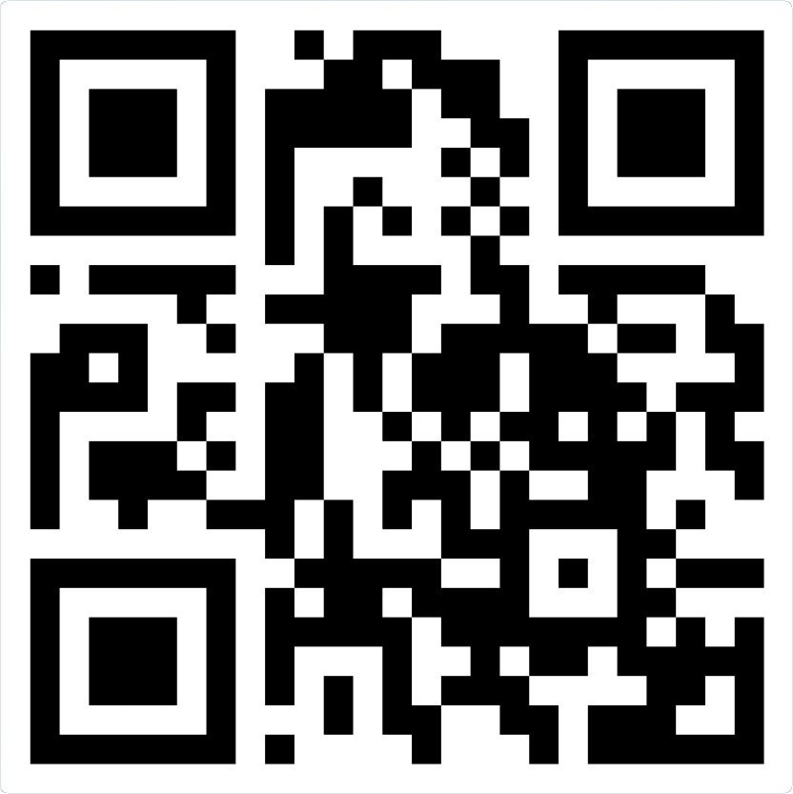
Please scan the QR code below
to participate in our live polling.
Join at:
vevox.app
ID:
499-847-075

Slide 14
In general, what is the minimum duration of remission after second-line venetoclax/anti-CD20 antibody before you would consider retreatment as third-line therapy?
2/3
Join at: vevox.app
ID: 499-847-075
Question slide
a. At least 6 months
b. At least 12 months
c. At least 24 months
d. At least 36 months
e. I’m not sure

Slide 15
In general, what is the minimum duration of remission after second-line venetoclax/anti-CD20 antibody before you would consider retreatment as third-line therapy?
2
Join at: vevox.app
ID: 499-847-075
Showing Results
a. At least 6 months
0%
b. At least 12 months
100%
c. At least 24 months
0%
d. At least 36 months
0%
e. I’m not sure
0%
RESULTS SLIDE

Slide 16
In general, what is the minimum duration of remission after second-line venetoclax/ anti-CD20 antibody before you would consider retreatment as third-line therapy?
12 months
12 months
>24 months
>24 months
24-36 months
36 months

Slide 17
75-year-old patient with relapsed CLL, no del(17p) or TP53 mutation:
Covalent BTKi 6 years → PD → venetoclax/anti-CD20 antibody 2 years →
3 years observation → PD. What would be your preferred next treatment?
2/3
Join at: vevox.app
ID: 499-847-075
Question slide
a. Alternative covalent BTK inhibitor
b. Venetoclax/anti-CD20 antibody
c. Pirtobrutinib
d. CAR T-cell therapy
e. Bispecific antibody
f. I’m not sure
BTKi = Bruton tyrosine kinase inhibitor; PD = disease progression; CAR-T = chimeric antigen receptor T-cell therapy

Slide 18
75-year-old patient with relapsed CLL, no del(17p) or TP53 mutation:
Covalent BTKi 6 years → PD → venetoclax/anti-CD20 antibody 2 years →
3 years observation → PD. What would be your preferred next treatment?
2/3
Join at: vevox.app
ID: 499-847-075
Showing Results
a. Alternative covalent BTK inhibitor
0%
b. Venetoclax/anti-CD20 antibody
0%
c. Pirtobrutinib
50%
d. CAR T-cell therapy
50%
e. Bispecific antibody
0%
f. I’m not sure
0%
RESULTS SLIDE
BTKi = Bruton tyrosine kinase inhibitor; PD = disease progression; CAR-T = chimeric antigen receptor T-cell therapy

Slide 19
75-year-old patient with relapsed CLL, no del(17p) or TP53 mutation:
Covalent BTKi 6 years → PD → venetoclax/anti-CD20 antibody 2 years →
3 years observation → PD
Venetoclax/anti-CD20 antibody
Venetoclax/anti-CD20 antibody
Pirtobrutinib
Venetoclax/anti-CD20 antibody
Pirtobrutinib bridge to CAR-T
Pirtobrutinib
BTKi = Bruton tyrosine kinase inhibitor; PD = disease progression; CAR-T = chimeric antigen receptor T-cell therapy

Slide 20
75-year-old patient with relapsed CLL, no del(17p) or TP53 mutation:
Covalent BTKi 6 years → PD → venetoclax/anti-CD20 antibody 2 years →
1 year observation → PD
Pirtobrutinib
Pirtobrutinib
Pirtobrutinib
Pirtobrutinib
Pirtobrutinib bridge to CAR-T
Pirtobrutinib

Slide 21
75-year-old patient with relapsed CLL, no del(17p) or TP53 mutation: Venetoclax/anti-CD20 antibody 1 year → 2 years observation → PD → covalent BTKi 4 years → PD. What would be your preferred next treatment?
2/3
Join at: vevox.app
ID: 499-847-075
Question slide
a. Alternative covalent BTK inhibitor
b. Venetoclax/anti-CD20 antibody
c. Pirtobrutinib
d. CAR T-cell therapy
e. Bispecific antibody
f. I’m not sure

Slide 22
75-year-old patient with relapsed CLL, no del(17p) or TP53 mutation: Venetoclax/anti-CD20 antibody 1 year → 2 years observation → PD → covalent BTKi 4 years → PD. What would be your preferred next treatment?
2
Join at: vevox.app
ID: 499-847-075
Showing Results
a. Alternative covalent BTK inhibitor
0%
b. Venetoclax/anti-CD20 antibody
0%
c. Pirtobrutinib
0%
d. CAR T-cell therapy
50%
e. Bispecific antibody
0%
f. I’m not sure
50%
RESULTS SLIDE

Slide 23
75-year-old patient with relapsed CLL, no del(17p) or TP53 mutation: Venetoclax/anti-CD20 antibody 1 year → 2 years observation → PD → covalent BTKi 4 years → PD
Pirtobrutinib
Venetoclax/anti-CD20 antibody
Pirtobrutinib or venetoclax/anti-CD20 antibody
Pirtobrutinib
Pirtobrutinib
Pirtobrutinib

Slide 24
75-year-old patient with relapsed CLL, no del(17p) or TP53 mutation: Venetoclax/anti-CD20 antibody 1 year → 4 years observation → PD → covalent BTKi 4 years → PD
Venetoclax/anti-CD20 antibody
Venetoclax/anti-CD20 antibody
Pirtobrutinib or venetoclax/anti-CD20 antibody
Venetoclax/anti-CD20 antibody
Pirtobrutinib
Pirtobrutinib

Slide 25
75-year-old patient with relapsed CLL, no del(17p) or TP53 mutation:
Covalent BTKi 2 years → responds but stops due to subdural hematoma → 3 years observation → PD → venetoclax/anti-CD20 antibody 2 years → 6 months observation → PD
Pirtobrutinib
Venetoclax monotherapy
CAR T-cell therapy or epcoritamab on clinical trial
Venetoclax monotherapy
Pirtobrutinib or CAR-T
Pirtobrutinib or CAR-T

Slide 26
75-year-old patient with relapsed CLL, no del(17p) or TP53 mutation:
Covalent BTKi 2 years → responds but stops due to arthralgias → 2 years observation → PD → venetoclax/anti-CD20 antibody 2 years → 6 months observation → PD
Alternative covalent BTKi
Alternative covalent BTKi
Alternative covalent BTKi
Alternative covalent BTKi or pirtobrutinib
Alternative covalent BTKi
Alternative covalent BTKi

Slide 27
Management of Double-Refractory CLL
Introduction: Sequencing of Treatment for CLL
Module 1: Clinician Survey Results
Module 2: Noncovalent BTK Inhibitor Pirtobrutinib
Module 3: Clinician Survey Results
Module 4: CAR T-Cell Therapy
Module 5: Clinician Survey Results
Module 6: Bispecific Antibodies and Promising Investigational Strategies

Slide 28
Key Datasets
Thompson PA, Tam CS. Pirtobrutinib: A new hope for patients with BTK inhibitor-refractory lymphoproliferative disorders. Blood 2023 June 29;141(26):3137-42.
Shah NN et al. Pirtobrutinib monotherapy in Bruton tyrosine kinase inhibitor-intolerant patients with B-cell malignancies: Results of the phase I/II BRUIN trial. Haematologica 2025 January 1;110(1):92-102.
Sharman JP et al. Phase III trial of pirtobrutinib versus idelalisib/rituximab or bendamustine/rituximab in covalent Bruton tyrosine kinase inhibitor-pretreated chronic lymphocytic leukemia/small lymphocytic lymphoma (BRUIN CLL-321). J Clin Oncol 2025 August;43(22):2538-49.
Galitzia A et al. Chronic lymphocytic leukemia: Management of adverse events in the era of targeted agents. Cancers (Basel) 2024 May 24;16(11):1996.
Jurczak W et al. Long-term safety with ≥12 months of pirtobrutinib in relapsed/refractory (R/R) B-cell malignancies. EHA 2023;Abstract P618.
Eyre TA et al. BRUIN CLL-322: A phase 3 open-label, randomized study of fixed duration pirtobrutinib plus venetoclax and rituximab versus venetoclax and rituximab in previously treated chronic lymphocytic leukemia/small lymphocytic lymphoma. ASCO 2023;Abstract TPS7583.
Escalón MP et al. BRUIN CLL-314: A phase 3, open-label, randomized study of pirtobrutinib versus ibrutinib in patients with chronic lymphocytic leukemia/small lymphocytic lymphoma (trial in progress). iwCLL 2023;Abstract 1548596.
Jurczak W et al. BRUIN CLL-313: A phase 3 open-label, randomized study of pirtobrutinib versus bendamustine plus rituximab in untreated patients with chronic lymphocytic leukemia/small lymphocytic lymphoma (trial in progress). ASH 2021;Abstract 3732.

Slide 29

Key Differences Between Available Covalent and Reversible Bruton Tyrosine Kinase (BTK) Inhibitors
Thompson PA, Tam CS. Blood 2023;141(26):3137-42.

Slide 30

Haematologica 2025;110(1):92-102.

Slide 31

BRUIN: Pirtobrutinib Efficacy in Patients with CLL or SLL Who Received Prior BTK Inhibitor (BTKi) Treatment
Overall response rate 76.9%
SPD = sum of product diameters
Shah NN et al. Haematologica 2025;110(1):92-102.

Slide 32

BRUIN: Median Progression-Free Survival for Patients with CLL/SLL
Shah NN et al. Haematologica 2025;110(1):92-102.

Slide 33

BRUIN: Pirtobrutinib Safety Profile in the Overall Population
Shah NN et al. Haematologica 2025;110(1):92-102.

Slide 34
FDA Grants Accelerated Approval to Pirtobrutinib for CLL or SLL
Press Release: December 1, 2023
“... the Food and Drug Administration granted accelerated approval to pirtobrutinib for adults with chronic lymphocytic leukemia or small lymphocytic lymphoma (CLL/SLL) who have received at least two prior lines of therapy, including a BTK inhibitor and a BCL-2 inhibitor.
Efficacy was evaluated in BRUIN (NCT03740529], an open-label, international, single-arm, multicohort trial that included 108 patients with CLL or SLL previously treated with at least two prior lines of therapy, including a BTK inhibitor and a BCL-2 inhibitor.
Pirtobrutinib was administered orally at 200 mg once daily and was continued until disease progression or unacceptable toxicity.
The main efficacy outcome measures were overall response rate (ORR) and duration of response (DOR), as assessed by an independent review committee using 2018 iwCLL criteria.”
https://www.fda.gov/drugs/resources-information-approved-drugs/fda-grants-accelerated-approval-pirtobrutinib-chronic-lymphocytic-leukemia-and-small-lymphocytic.

Slide 35

J Clin Oncol 2025;43:2538-49.

Slide 36
Which of the following best describes the major progression-free survival (PFS) findings from the Phase III BRUIN CLL-321 study of pirtobrutinib monotherapy versus idelalisib/rituximab or bendamustine/rituximab for relapsed/refractory CLL?
2/3
Join at: vevox.app
ID: 499-847-075
Question slide
a. Inferior PFS outcomes with pirtobrutinib monotherapy
b. A numerical but nonsignificant improvement in PFS with pirtobrutinib monotherapy
c. A statistically significant improvement in PFS with pirtobrutinib monotherapy
d. I'm not sure

Slide 37
Which of the following best describes the major progression-free survival (PFS) findings from the Phase III BRUIN CLL-321 study of pirtobrutinib monotherapy versus idelalisib/rituximab or bendamustine/rituximab for relapsed/refractory CLL?
2/3
Join at: vevox.app
ID: 499-847-075
Preparing Results
a. Inferior PFS outcomes with pirtobrutinib monotherapy
0%
b. A numerical but nonsignificant improvement in PFS with pirtobrutinib monotherapy
50%
c. A statistically significant improvement in PFS with pirtobrutinib monotherapy
50%
d. I'm not sure
0%
RESULTS SLIDE

Slide 38
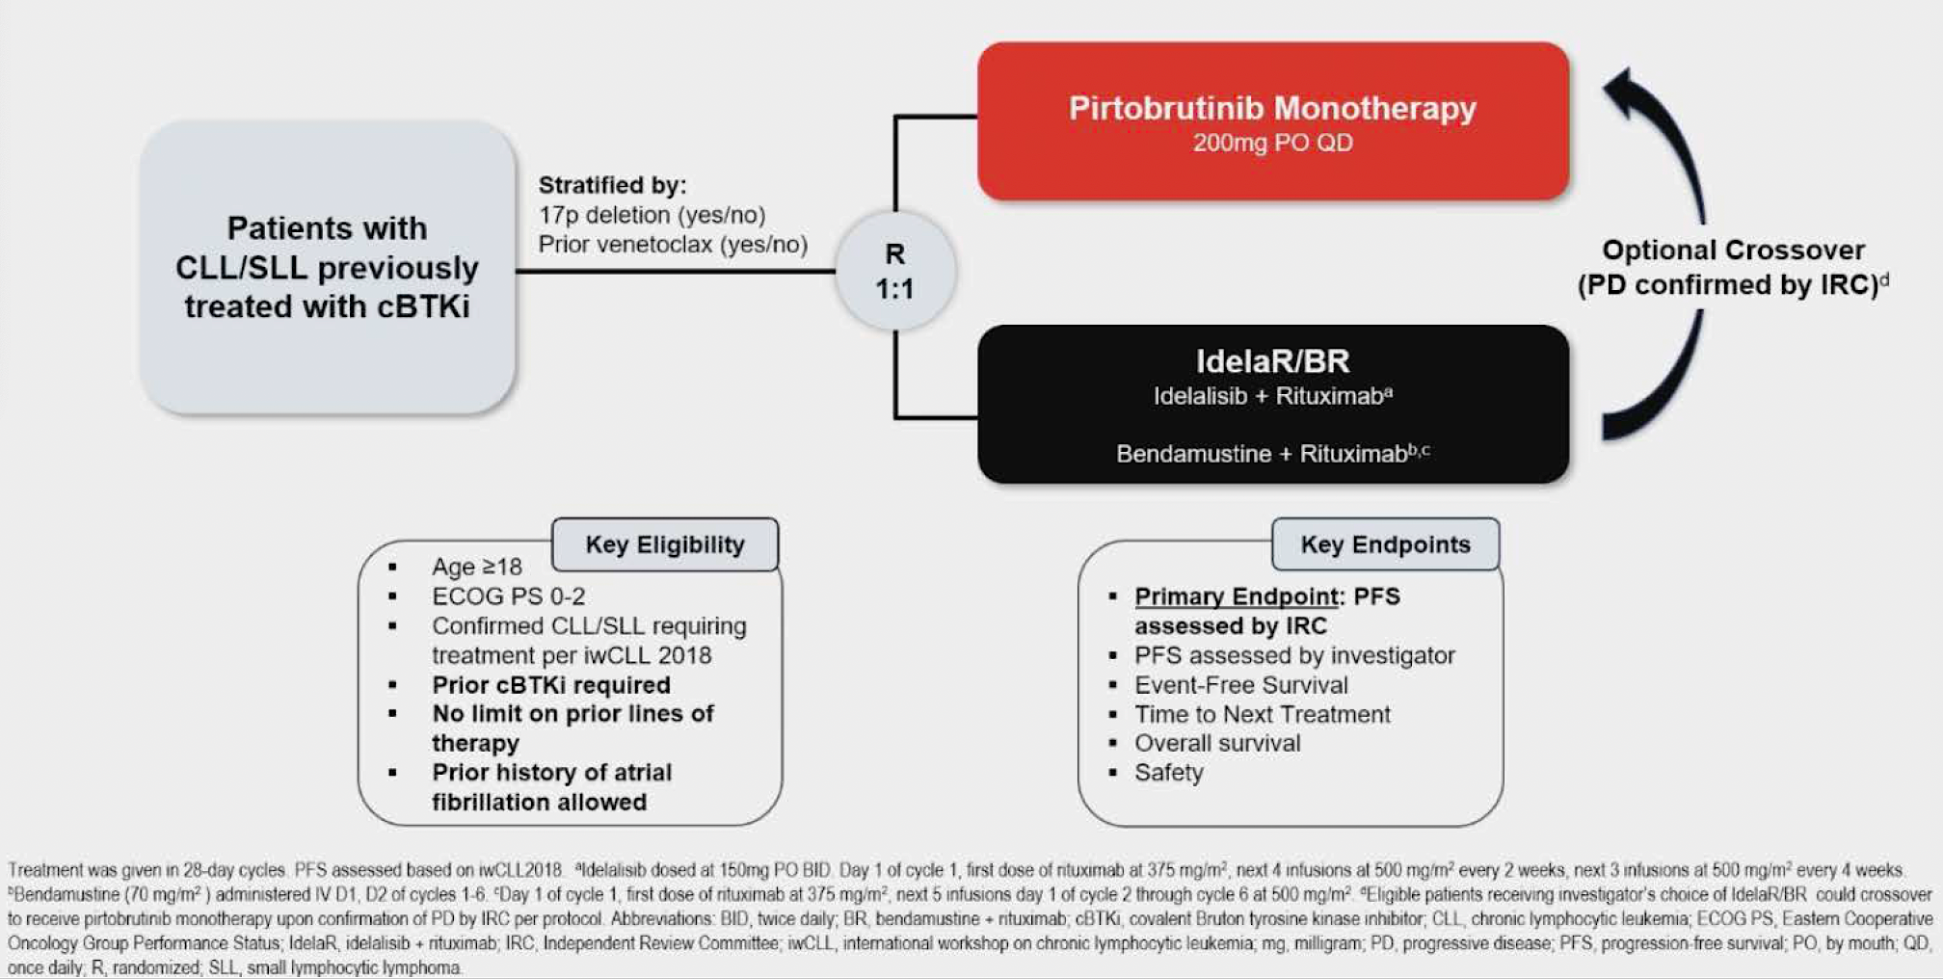
BRUIN CLL-321: A Phase III Trial of Pirtobrutinib Monotherapy for Relapsed/Refractory CLL
Sharman JP et al. ASH 2024;Abstract 886.

Slide 39

BRUIN CLL-321: IRC-Assessed Progression-Free Survival (PFS)
IRC = independent review committee
Sharman JP et al. J Clin Oncol 2025;43:2538-49.

Slide 40

BRUIN CLL-321: Time to Next Treatment
Sharman JP et al. J Clin Oncol 2025;43:2538-49.

Slide 41

BRUIN CLL-321: Overall Survival
Sharman JP et al. J Clin Oncol 2025;43:2538-49.

Slide 42
Which of the following ≥Grade 3 adverse events was most commonly reported in patients receiving pirtobrutinib for previously treated CLL in the Phase III BRUIN CLL-321 trial?
2/3
Join at: vevox.app
ID: 499-847-075
Question slide
a. Atrial fibrillation
b. Infections
c. Keratitis
d. Hemorrhage
e. I’m not sure

Slide 43
Which of the following ≥Grade 3 adverse events was most commonly reported in patients receiving pirtobrutinib for previously treated CLL in the Phase III BRUIN CLL-321 trial?
2/3
Join at: vevox.app
ID: 499-847-075
Preparing Results
a. Atrial fibrillation
50%
b. Infections
0%
c. Keratitis
0%
d. Hemorrhage
50%
e. I’m not sure
0%
RESULTS SLIDE

Slide 44

BRUIN CLL-321: Safety Profile
TEAE = treatment-emergent adverse event; IR = incidence rate; IRR = IR ratio
Sharman JP et al. J Clin Oncol 2025;43:2538-49.

Slide 45
Incidence and Management Recommendations for Select BTK Inhibitor-Associated Cardiologic Adverse Events and Bleeding
Adverse event | BTK inhibitor | Incidence Any grade, Grade ≥3 % | Management
Atrial fibrillation | Ibrutinib | 16, 2-5 | Avoid stroke; anticoagulation Better symptom control: rate vs rhythm Cardiovascular and other comorbidity management
 | Acalabrutinib | 6-9, 1-5
 | Zanubrutinib | 3-6, ≤1
 | Pirtobrutinib | 2.8, 1.2
Hypertension | Ibrutinib | 16-23, 8-12 | Correct predisposing factors Antihypertensive therapy
 | Acalabrutinib | 7-9, 3-4
 | Zanubrutinib | 14-17, 6-15
 | Pirtobrutinib | 9.2, 2.3
Bleeding | Ibrutinib | 36-51, 3-4 | Minor bleeding: no intervention Major bleeding: Consider treatment discontinuation Platelet transfusions regardless of platelet counts
 | Acalabrutinib | 36-51, 3
 | Zanubrutinib | 36-45, 3
 | Pirtobrutinib | —
Galitzia A et al. Cancers 2024;16:1996; Jurczak W et al. EHA 2023;Abstract P618.

Slide 46
Incidence and Management Recommendations for Select BTK Inhibitor-Associated Noncardiovascular Adverse Events
Adverse event | BTK inhibitor | Incidence Any grade, Grade ≥3 % | Management
Neutropenia | Ibrutinib | 25-39, 13-31 | Growth factor support
 | Acalabrutinib | 21-23, 13-19
 | Zanubrutinib | 37-34, 15-19
 | Pirtobrutinib | 25, 20.3
Diarrhea | Ibrutinib | 22-59, <1-4 | Symptomatic treatments and dose adjustments Dietary modifications, hydration, anti-diarrheal medications Probiotics
 | Acalabrutinib | 18-39, 1-5
 | Zanubrutinib | 14-18, <1-2
 | Pirtobrutinib | 24.2, 0-9
Headache | Ibrutinib | 14-18, 1-2 | Moderate dose of caffeine or acetaminophen
 | Acalabrutinib | 22-39, <1
 | Zanubrutinib | 11-12, 0-1
 | Pirtobrutinib | 13.1, 0.5
Galitzia A et al. Cancers 2024;16:1996; Jurczak W et al. EHA 2023;Abstract P618.

Slide 47

BRUIN CLL-322: An Ongoing Phase III Trial of Pirtobrutinib and Venetoclax/Rituximab for Relapsed/Refractory CLL
Primary endpoint: Progression-free survival per iwCLL 2018 by IRC
Eyre TA et al. ASCO 2023;Abstract TPS7583. Wierda WG et al. SOHO 2022;Abstract CLL-322.

Slide 48
Which of the following descriptions best characterizes the study design of the BRUIN CLL-314 trial?
2/3
Join at: vevox.app
ID: 499-847-075
Question slide
a. A Phase II study evaluating time-limited pirtobrutinib for patients with CLL that was pretreated with prior BTK inhibitor and Bcl-2 inhibitor therapy
b. A Phase III superiority study evaluating pirtobrutinib versus ibrutinib for relapsed/refractory CLL
c. A Phase III noninferiority study evaluating pirtobrutinib versus ibrutinib for patients with CLL that was treatment-naïve or pretreated with non-BTK inhibitor therapy
d. I’m not sure

Slide 49
Which of the following descriptions best characterizes the study design of the BRUIN CLL-314 trial?
2/3
Join at: vevox.app
ID: 499-847-075
Preparing Results
a. A Phase II study evaluating time-limited pirtobrutinib for patients with CLL that was pretreated with prior BTK inhibitor and Bcl-2 inhibitor therapy
0%
b. A Phase III superiority study evaluating pirtobrutinib versus ibrutinib for relapsed/refractory CLL
50%
c. A Phase III noninferiority study evaluating pirtobrutinib versus ibrutinib for patients with CLL that was treatment-naïve or pretreated with non-BTK inhibitor therapy
50%
d. I’m not sure
0%
RESULTS SLIDE

Slide 50
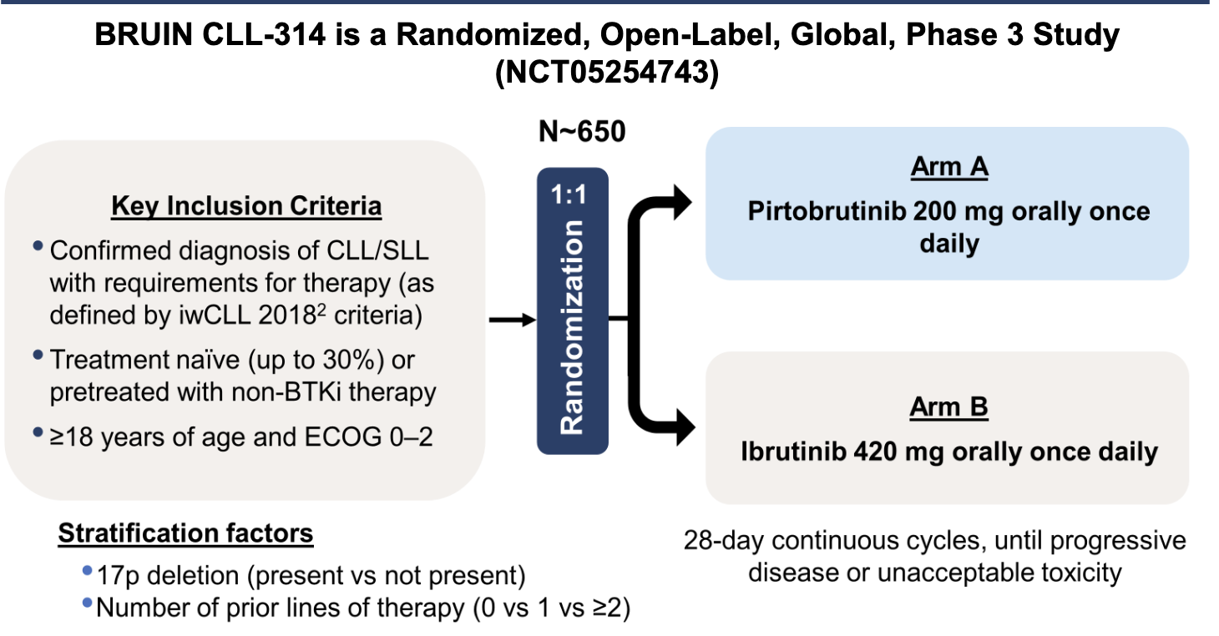
BRUIN CLL-314: A Phase III Trial of Pirtobrutinib versus Ibrutinib for Patients with CLL/SLL
Primary Endpoint
To establish noninferiority of pirtobrutinib to ibrutinib by comparing the overall response rate per iwCLL criteria as assessed by IRC
Key Secondary Endpoints
To determine the superiority of pirtobrutinib to ibrutinib with respect to IRC-assessed
event-free survival and progression-free survival
Escalón MP et al. iwCLL 2023;Abstract 1548596.

Slide 51
Phase III BRUIN CLL-314 Trial of Pirtobrutinib versus Ibrutinib for CLL/SLL Meets Primary Endpoint
Press Release: July 29, 2025
Positive topline results were announced from the Phase III BRUIN CLL-314 trial comparing pirtobrutinib, a noncovalent (reversible) BTK inhibitor, to ibrutinib, a covalent BTK inhibitor, for patients with treatment-naïve CLL/SLL.
“This study enrolled patients with treatment-naïve CLL/SLL and those who had been previously treated but were BTK inhibitor-naïve. The study met its primary endpoint of non-inferiority on overall response rate (ORR) as assessed by an independent review committee (IRC) in both the pre-treated and intent-to-treat populations. ORR favored pirtobrutinib with a nominal P-value for superiority (p <0.05). Progression free survival (PFS), a key secondary endpoint, was not yet mature at this analysis, but was trending in favor of pirtobrutinib. A formal PFS analysis testing for superiority is planned at a future analysis. No detriment was observed for overall survival (OS).
The overall safety profile of pirtobrutinib in BRUIN CLL-314 was similar to previously reported trials. Detailed results will be presented at a medical congress later in 2025.”
https://investor.lilly.com/news-releases/news-release-details/lillys-jaypirca-pirtobrutinib-first-and-only-approved-non

Slide 52
BRUIN CLL-314: Pirtobrutinib vs Ibrutinib
662 patients were randomized: 225 TN and 437 R/R
Primary endpoint was ORR and powered for non-inferiority
Pirtobrutinib was non-inferior for ORR in ITT and R/R cohorts
ORR ITT | 18-month PFS ITT | Atrial Fibrillation Hypertension
87.0% | 86.9% | 2.4% 10.6%
78.6% | 82.3% | 13.5% 15.1%
p<0.0001
1:1
Pirtobrutinib
Ibrutinib
Woyach et al., ASH 2025 (abstract)
Courtesy of Kerry A Rogers, MD

Slide 53
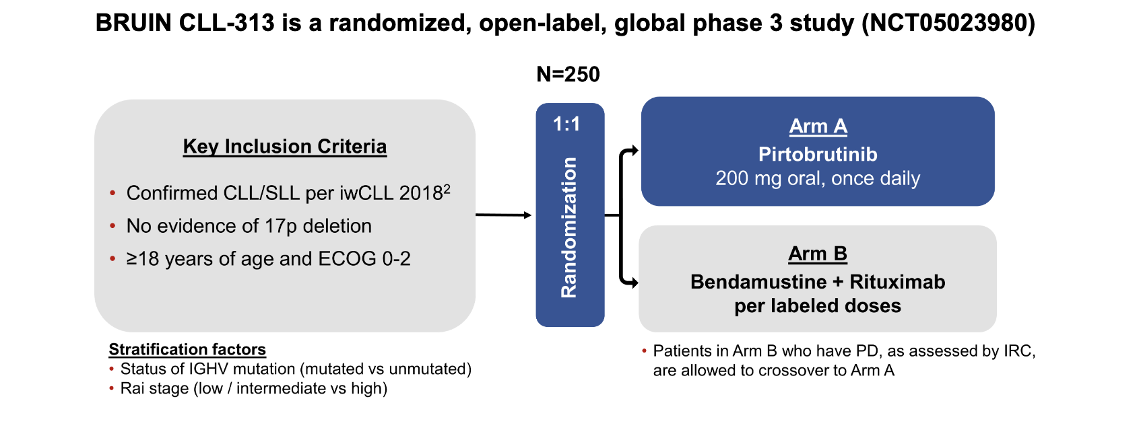
BRUIN CLL-313: A Phase III Trial Comparing Pirtobrutinib to Bendamustine/Rituximab for Untreated CLL/SLL
PD = disease progression
Jurczak W et al. ASH 2021;Abstract 3732.

Slide 54
Phase III BRUIN CLL-313 Trial of First-Line Pirtobrutinib versus Bendamustine/Rituximab in CLL Meets Primary Endpoint
Press Release: September 8, 2025
Positive topline results were announced from the Phase III BRUIN CLL-313 trial of pirtobrutinib, a noncovalent (reversible) BTK inhibitor, versus chemoimmunotherapy (bendamustine and rituximab) for patients with treatment-naïve CLL/SLL without 17p deletions.
“The study met its primary endpoint, demonstrating a highly statistically significant and clinically meaningful improvement in progression-free survival (PFS) compared to chemoimmunotherapy, as assessed by an independent review committee (IRC), indicating one of the most compelling effect sizes ever observed for a single agent BTK inhibitor in a front-line CLL study.
Overall survival (OS), a key secondary endpoint, was not yet mature at this analysis, but was trending strongly in favor of pirtobrutinib and will be tested for statistical significance at the time of the primary OS analysis, which is anticipated to occur in 2026. The overall safety profile of pirtobrutinib in BRUIN CLL-313 was generally consistent with previously reported trials across treatment settings.
Detailed results will be presented at a medical congress and submitted to a peer-reviewed journal.”
https://www.prnewswire.com/news-releases/lillys-jaypirca-pirtobrutinib-the-first-and-only-approved-non-covalent-reversible-btk-inhibitor-significantly-improved-progression-free-survival-in-patients-with-treatment-naive-cllsll-302548399.html

Slide 55
Management of Double-Refractory CLL
Introduction: Sequencing of Treatment for CLL
Module 1: Clinician Survey Results
Module 2: Noncovalent BTK Inhibitor Pirtobrutinib
Module 3: Clinician Survey Results
Module 4: CAR T-Cell Therapy
Module 5: Clinician Survey Results
Module 6: Bispecific Antibodies and Promising Investigational Strategies

Slide 56
Based on current clinical trial data and your personal experience, how would you compare the global tolerability/toxicity of pirtobrutinib to that of ibrutinib, acalabrutinib and zanubrutinib for patients with relapsed/refractory CLL?
2/3
Join at: vevox.app
ID: 499-847-075
Question slide
a. About the same
b. Ibrutinib has the least toxicity
c. Acalabrutinib has the least toxicity
d. Zanubrutinib has the least toxicity
e. Pirtobrutinib has the least toxicity
f. I’m not sure

Slide 57
Based on current clinical trial data and your personal experience, how would you compare the global tolerability/toxicity of pirtobrutinib to that of ibrutinib, acalabrutinib and zanubrutinib for patients with relapsed/refractory CLL?
2
Join at: vevox.app
ID: 499-847-075
Showing Results
a. About the same
0%
b. Ibrutinib has the least toxicity
0%
c. Acalabrutinib has the least toxicity
0%
d. Zanubrutinib has the least toxicity
50%
e. Pirtobrutinib has the least toxicity
50%
f. I’m not sure
RESULTS SLIDE
0%

Slide 58
Based on current clinical trial data and your personal experience, how would you compare the global efficacy and tolerability/toxicity of pirtobrutinib to that of ibrutinib, acalabrutinib and zanubrutinib for patients with relapsed/refractory CLL?
Efficacy
Tolerability/toxicity
There are not enough
available data at this time
Pirtobrutinib has the least toxicity
About the same
Pirtobrutinib has the least toxicity
There are not enough
available data at this time
Pirtobrutinib has the least toxicity
About the same
Pirtobrutinib has the least toxicity
There are not enough
available data at this time
Pirtobrutinib has the least toxicity
Acalabrutinib and zanubrutinib
are the most efficacious
Pirtobrutinib has the least toxicity

Slide 59
An older patient with newly diagnosed CLL and a significant history of atrial fibrillation has come to you for a second opinion following the recommendation of first-line treatment with pirtobrutinib. How would you respond?
2/3
Join at: vevox.app
ID: 499-847-075
Question slide
a. I agree with this recommendation
b. I do not agree with the recommendation, but it is a valid option
c. I do not agree with this recommendation

Slide 60
An older patient with newly diagnosed CLL and a significant history of atrial fibrillation has come to you for a second opinion following the recommendation of first-line treatment with pirtobrutinib. How would you respond?
2/3
Join at: vevox.app
ID: 499-847-075
Showing Results
a. I agree with this recommendation
50%
b. I do not agree with the recommendation, but it is a valid option
50%
c. I do not agree with this recommendation
0%
RESULTS SLIDE

Slide 61
An older patient with newly diagnosed CLL and a significant history of atrial fibrillation has come to you for a second opinion after the recommendation of first-line treatment with pirtobrutinib. How would you respond?
I do not agree with the recommendation, but it is a valid option
I do not agree with the recommendation, but it is a valid option
I do not agree with the recommendation, but it is a valid option
I do not agree with this recommendation
I do not agree with this recommendation
I agree with this recommendation

Slide 62
Management of Double-Refractory CLL
Introduction: Sequencing of Treatment for CLL
Module 1: Clinician Survey Results
Module 2: Noncovalent BTK Inhibitor Pirtobrutinib
Module 3: Clinician Survey Results
Module 4: CAR T-Cell Therapy
Module 5: Clinician Survey Results
Module 6: Bispecific Antibodies and Promising Investigational Strategies

Slide 63
Key Datasets
Siddiqi T et al. Lisocabtagene maraleucel (liso-cel) in R/R CLL/SLL: 24-month median follow-up of TRANSCEND CLL 004. ASH 2023;Abstract 330.
Wierda WG et al. Lisocabtagene maraleucel (liso-cel) combined with ibrutinib (ibr) for patients (pts) with relapsed or refractory (R/R) chronic lymphocytic leukemia (CLL)/small lymphocytic lymphoma (SLL): Primary results from the open-label, phase 1/2 Transcend CLL 004 study. ASH 2024;Abstract 887.

Slide 64


Slide 65

TRANSCEND CLL 004: Duration of Response by Best Overall Response
PEAS (BTKi progression/venetoclax failure subset) at DL2 (n = 50)
Full Study Population at DL2 (n = 88)
Siddiqi T et al. ASH 2023;Abstract 330.

Slide 66
FDA Grants Accelerated Approval to Lisocabtagene Maraleucel for Relapsed/Refractory (R/R) CLL or SLL
Press Release: March 14, 2024
“… the US Food and Drug Administration (FDA) has granted accelerated approval of lisocabtagene maraleucel (liso-cel), a CD19-directed chimeric antigen receptor (CAR) T cell therapy, for the treatment of adult patients with relapsed or refractory chronic lymphocytic leukemia (CLL) or small lymphocytic lymphoma (SLL) who have received at least two prior lines of therapy, including a Bruton tyrosine kinase (BTK) inhibitor and a B-cell lymphoma 2 (BCL-2) inhibitor. This indication is approved under accelerated approval based on response rate and duration of response. Continued approval for this indication may be contingent upon verification and description of clinical benefit in confirmatory trial(s). In R/R CLL or SLL, liso-cel is delivered through a treatment process which culminates in a one-time infusion with a single dose containing 90 to 110 x 10⁶ CAR-positive viable T cells.”
Accelerated approval was based on results from the Phase I/II open-label, single-arm TRANSCEND CLL 004 study for patients with R/R CLL or SLL.
https://news.bms.com/news/details/2024/U.S.-FDA-Approves-Bristol-Myers-Squibbs-Breyanzi--as-the-First-and-Only-CAR-T-Cell-Therapy-for-Adults-with-Relapsed-or-Refractory-Chronic-Lymphocytic-Leukemia-CLL-or-Small-Lymphocytic-Lymphoma-SLL/default.aspx

Slide 67


Slide 68

TRANSCEND CLL 004: Lisocabtagene Maraleucel (Liso-cel) and Ibrutinib Combination Cohort
Wierda WG et al. ASH 2024;Abstract 887.

Slide 69

TRANSCEND CLL 004: Efficacy Outcomes with Liso-cel and Ibrutinib
CR = complete response; CRi = CR with incomplete marrow recovery; ORR = overall response rate
Wierda WG et al. ASH 2024;Abstract 887.

Slide 70

TRANSCEND CLL 004: Incidence of Cytokine Release Syndrome (CRS) and Neurological Adverse Events (NEs) with Liso-cel and Ibrutinib
Wierda WG et al. ASH 2024;Abstract 887.

Slide 71
Management of Double-Refractory CLL
Introduction: Sequencing of Treatment for CLL
Module 1: Clinician Survey Results
Module 2: Noncovalent BTK Inhibitor Pirtobrutinib
Module 3: Clinician Survey Results
Module 4: CAR T-Cell Therapy
Module 5: Clinician Survey Results
Module 6: Bispecific Antibodies and Promising Investigational Strategies

Slide 72
At what point in the treatment course are you referring patients with multiregimen-relapsed CLL for consultation regarding chimeric antigen receptor (CAR) T-cell therapy?
2/2
Join at: vevox.app
ID: 499-847-075
Question slide
a. At first relapse
b. At second relapse
c. At third relapse
d. After third relapse
e. I am not referring patients with CLL for CAR T-cell therapy
f. I’m not sure

Slide 73
At what point in the treatment course are you referring patients with multiregimen-relapsed CLL for consultation regarding chimeric antigen receptor (CAR) T-cell therapy?
2/2
Join at: vevox.app
ID: 499-847-075
Showing Results
a. At first relapse
0%
b. At second relapse
50%
c. At third relapse
0%
d. After third relapse
50%
e. I am not referring patients with CLL for CAR T-cell therapy
0%
f. I’m not sure
0%
RESULTS SLIDE

Slide 74
At what point in the treatment course are you referring patients with multiregimen-relapsed CLL for consultation regarding chimeric antigen receptor (CAR) T-cell therapy?
After third relapse
After third relapse
After third relapse
After third relapse
At second relapse
At second relapse

Slide 75
Approximately how many patients with CLL in your practice have received CAR T-cell therapy on or off protocol?
0 patients
10 patients
20 patients
5 patients
4 patients
5 patients

Slide 76
Management of Double-Refractory CLL
Introduction: Sequencing of Treatment for CLL
Module 1: Clinician Survey Results
Module 2: Noncovalent BTK Inhibitor Pirtobrutinib
Module 3: Clinician Survey Results
Module 4: CAR T-Cell Therapy
Module 5: Clinician Survey Results
Module 6: Bispecific Antibodies and Promising Investigational Strategies

Slide 77
Key Datasets
Cassanello G et al. Trial watch: Bispecific antibodies for the treatment of relapsed or refractory large B-cell lymphoma. Oncoimmunology 2024 March 3;13(1):2321648.
Danilov A et al. Epcoritamab monotherapy in patients (pts) with relapsed or refractory (R/R) chronic lymphocytic leukemia (CLL): Results from CLL expansion and optimization cohorts of Epcore CLL-1. ASH 2024;Abstract 883.
Scarfò L et al. Updated efficacy and safety of the Bruton tyrosine kinase (BTK) degrader BGB-16673 in patients (pts) with relapsed or refractory (R/R) CLL/SLL: Results from the ongoing phase (ph) 1 CADANCE-101 study. EHA 2025;Abstract S158.
Shah NN et al. Efficacy and safety of the Bruton’s tyrosine kinase (BTK) degrader NX-5948 in patients with relapsed/refractory (R/R) chronic lymphocytic leukemia (CLL): Updated results from an ongoing phase 1a/b study. ASH 2024;Abstract 884.
Woyach JA et al. First-in-human study of the reversible BTK inhibitor nemtabrutinib in patients with relapsed/refractory chronic lymphocytic leukemia and B-cell non-Hodgkin lymphoma. Cancer Discov 2024;14(1):66-75.

Slide 78

Mechanism of Action of CD20 x CD3 Bispecific Antibodies
Cassanello G et al. Oncoimmunology 2024;13(1):2321648.

Slide 79

ASH 2024;Abstract 883

Slide 80

EPCORE CLL-1 Trial Expansion and Cycle 1 Optimization
ICANS = immune effector cell-associated neurotoxicity syndrome; TLS = tumor lysis syndrome; PMBC = peripheral blood mononuclear cell
Danilov A et al. ASH 2024;Abstract 883.

Slide 81

EPCORE CLL-1: Response Across Subgroups
Danilov A et al. ASH 2024;Abstract 883.

Slide 82

EPCORE CLL-1: Treatment-Emergent Adverse Events (TEAES)
Danilov A et al. ASH 2024;Abstract 883.

Slide 83


BGB-16673: A Chimeric Degradation Activating Compound
BGB-16673 is an orally available protein degrader that blocks BTK signaling by tagging BTK for degradation through the cell’s proteasome pathway, leading to tumor regression
Scarfò L et al. EHA 2025;Abstract S158.

Slide 84

CaDAnCe-101: A Phase I/II Dose-Escalation/Expansion Study of BGB-16673 for R/R B-Cell Cancers
Scarfò L et al. EHA 2025;Abstract S158.

Slide 85
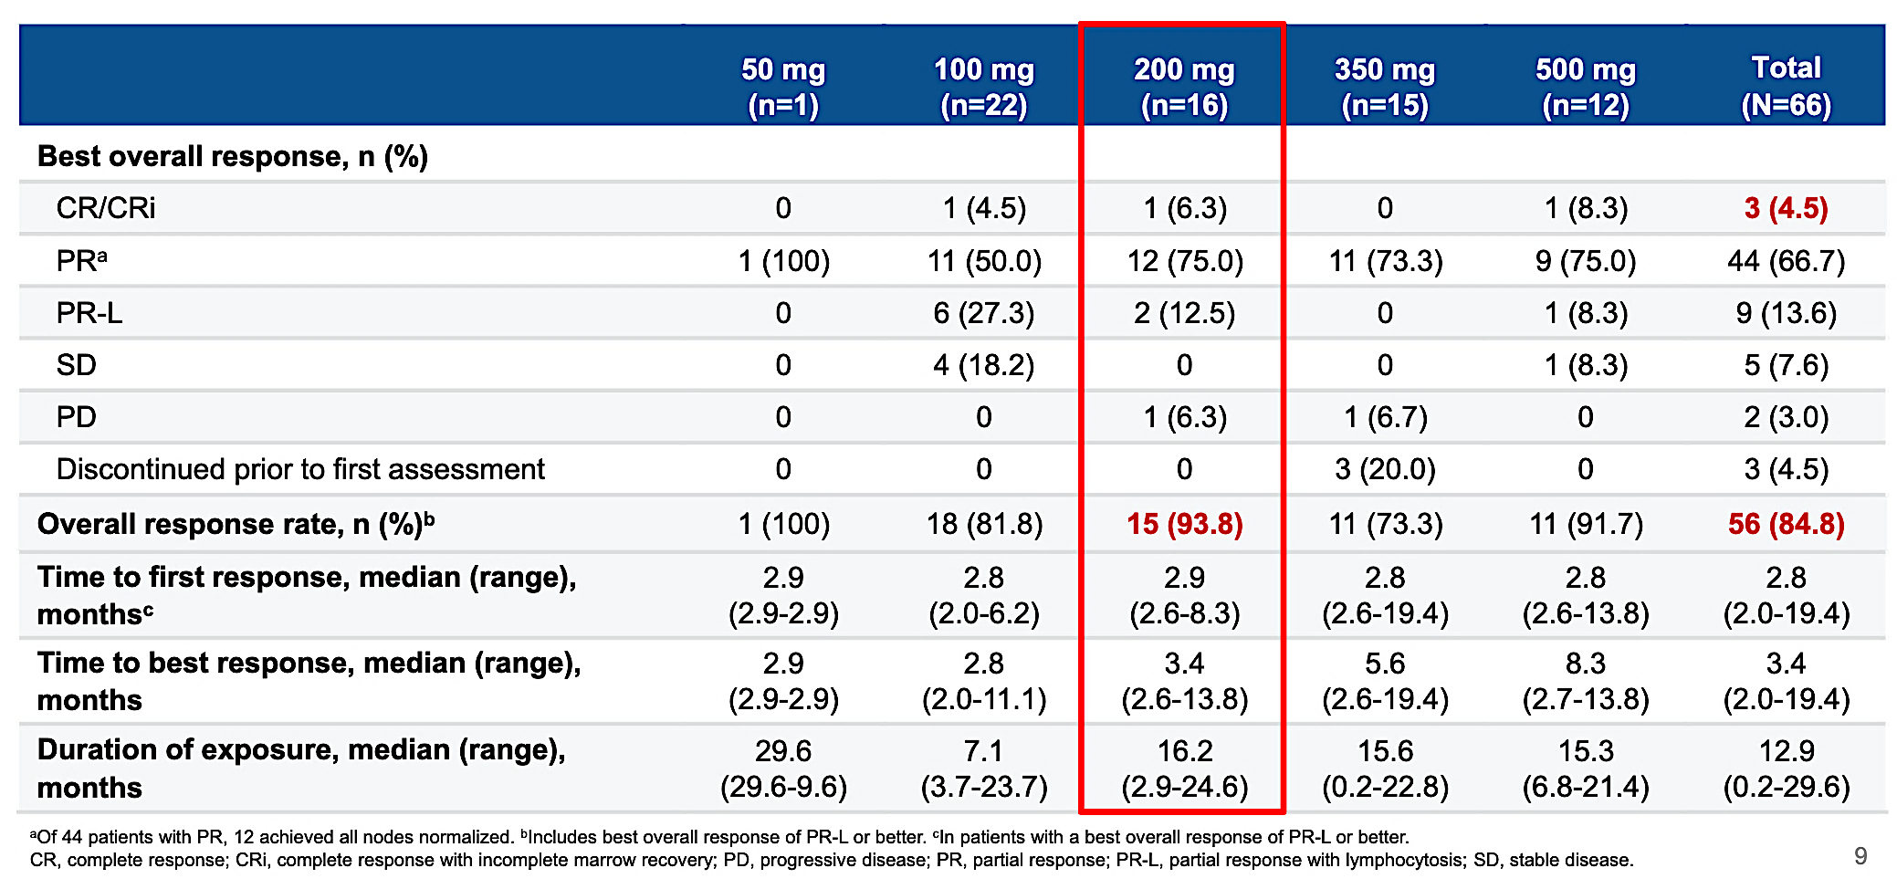
CaDAnCe-101: Overall Response Rate
Scarfò L et al. EHA 2025;Abstract S158.

Slide 86
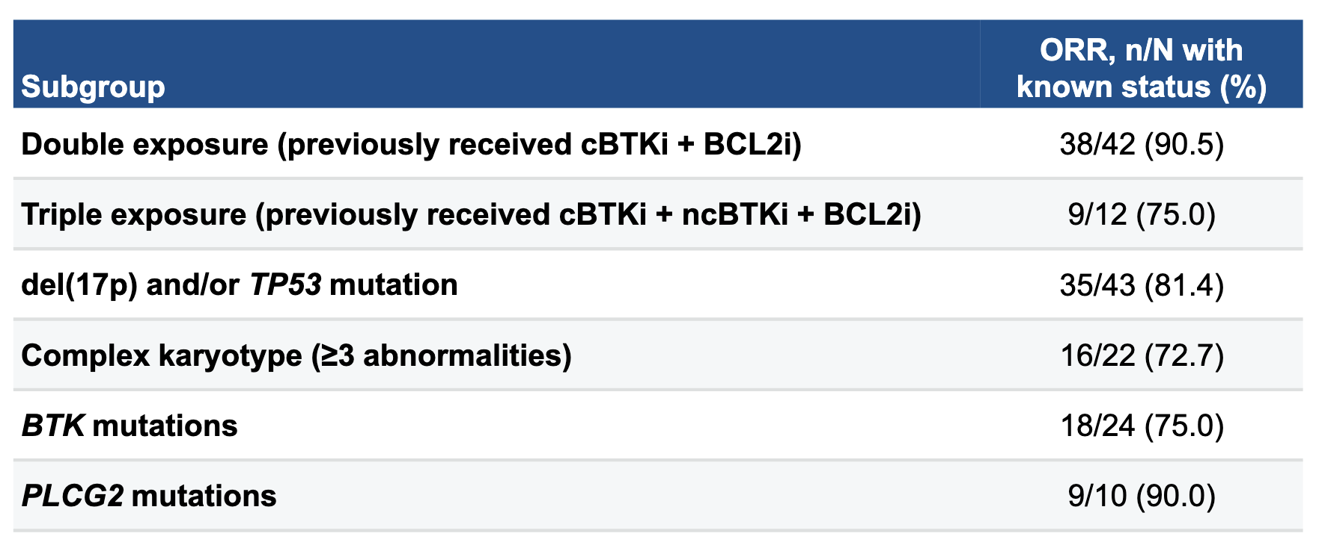
CaDAnCe-101: Overall Response Rate in High-Risk Subgroups
Scarfò L et al. EHA 2025;Abstract S158.

Slide 87
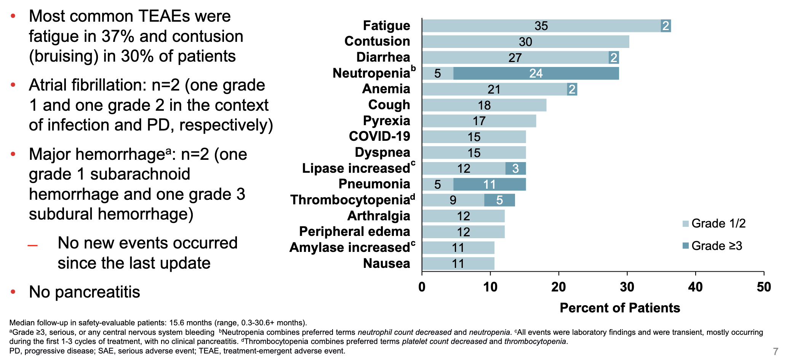
CaDAnCe-101: Summary of All-Grade TEAEs in ≥10% of All Patients
Scarfò L et al. EHA 2025;Abstract S158.

Slide 88
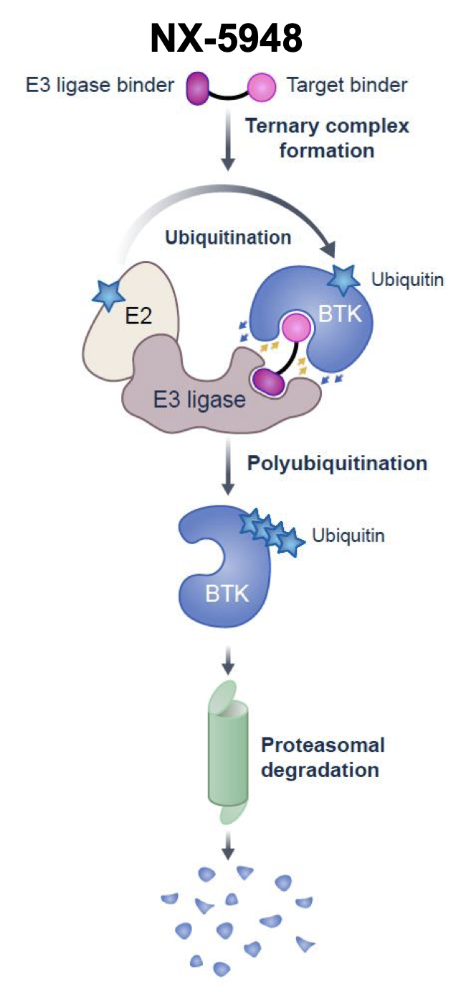
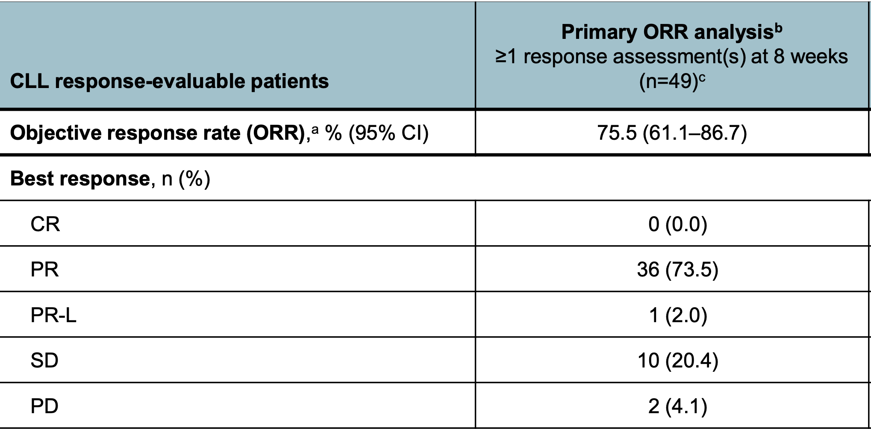
NX-5948: A Novel BTK Degrader
Shah NN et al. ASH 2024;Abstract 884.

Slide 89
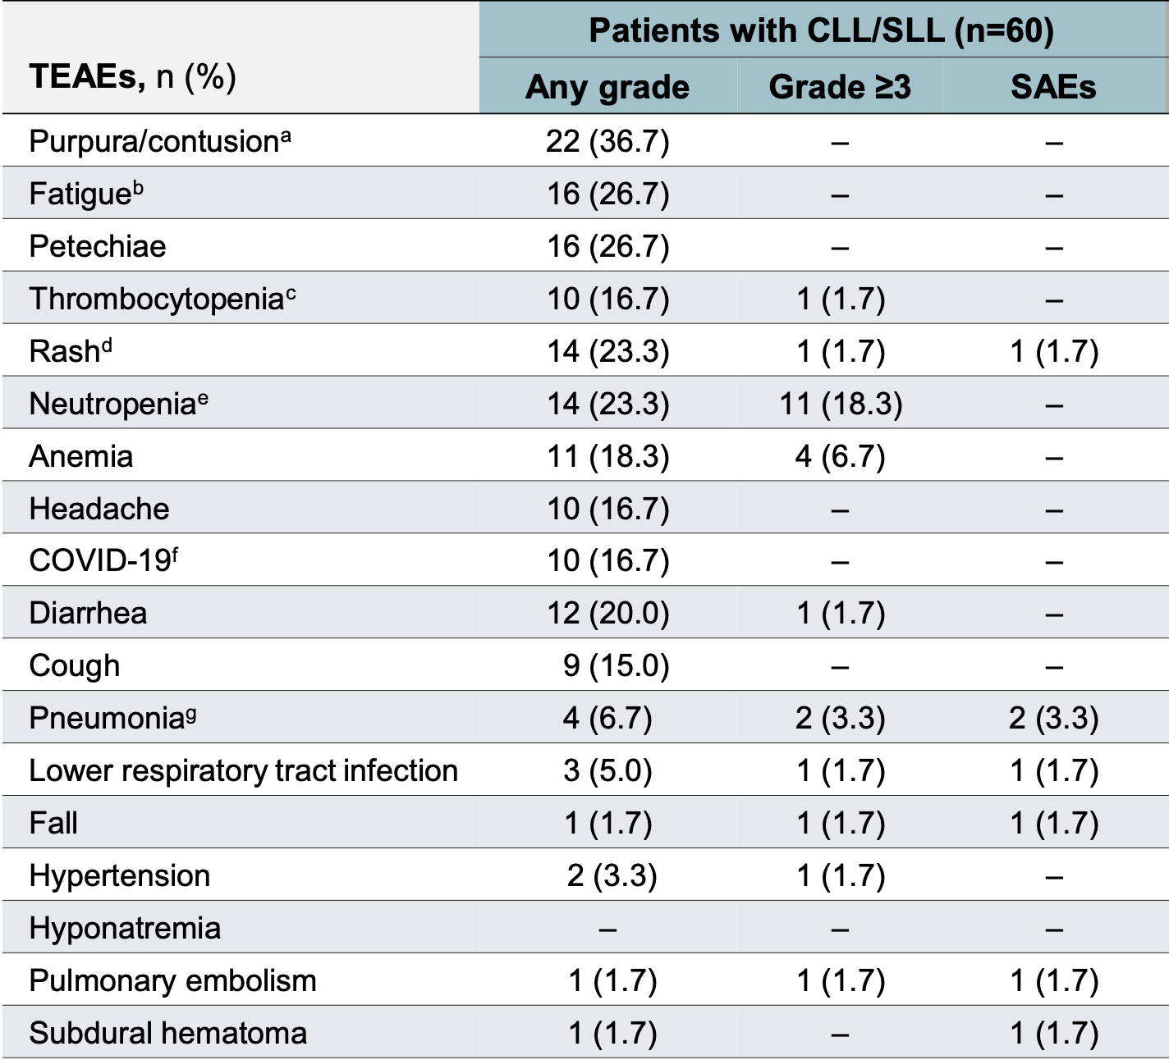
NX-5948: A Novel BTK Degrader – Safety Profile
TEAE = treatment-emergent adverse event; SAE = serious adverse event
Shah NN et al. ASH 2024;Abstract 884.

Slide 90

Nemtabrutinib: A Novel Reversible BTK Inhibitor
In a Phase I study, among the 22 patients with CLL, 8 (36.4%) achieved at least a partial remission with lymphocytosis as best response.
Among the 47 patients with CLL or NHL in the safety analysis, atrial fibrillation was reported in 1 patient (Grade 3), and no ventricular arrhythmias or unexplained deaths were reported. Hypertension was reported in 32% of patients (Grade 2 in 17%, Grade 3 in 15%).
Woyach JA et al. Cancer Discov 2024;14(1):66-75.

Slide 91
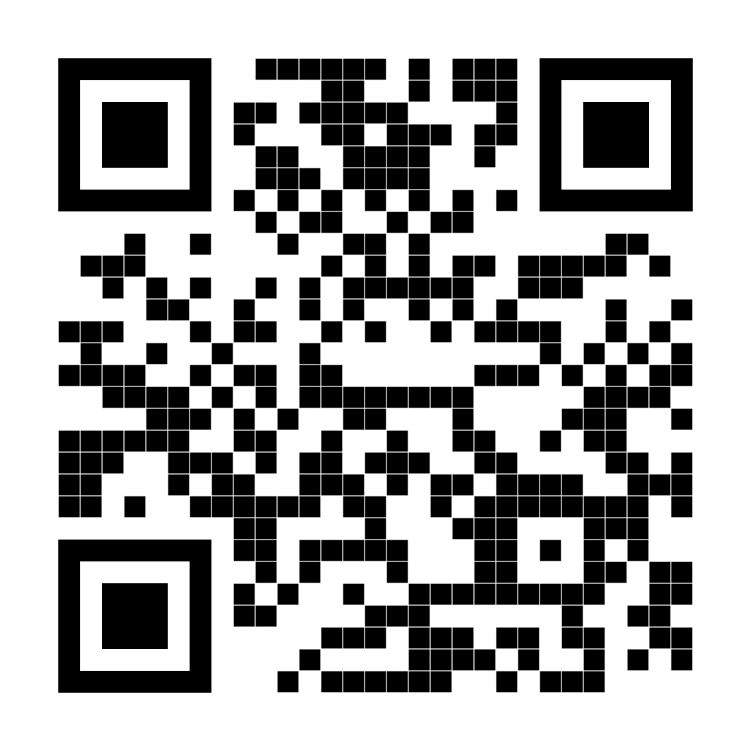
Thank you for attending!
Please complete the postactivity educational survey by scanning
the QR code below, and receive a $50 Amazon gift card.
Your input is greatly appreciated and helps
guide our future educational activities.

