Slide 1
Optimizing the Selection of First-Line Therapy for Patients with Multiple Myeloma
A CME/MOC-Accredited Live Webinar
Tuesday,​ July 1, 2025 5:00 PM – 6:00 PM ET
Faculty
Xavier Leleu, MD, PhD Peter Voorhees, MD
Moderator
Neil Love, MD

Slide 2
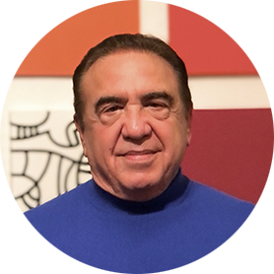
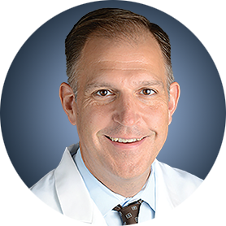
Faculty
Xavier Leleu, MD, PhD
Professor, Head of Myeloma Clinic
Head of Department of Hematology
Hôpital La Miletrie
Poitiers University Hospital
Poitiers, France
MODERATOR
Neil Love, MD Research To Practice Miami, Florida
Peter Voorhees, MD
Professor of Medicine
Wake Forest University School of Medicine
Chief, Plasma Cell Disorders Division
Atrium Health/Levine Cancer Institute
Associate Director of Clinical Research
Atrium Health Wake Forest Baptist Comprehensive Cancer Center
Charlotte, North Carolina

Slide 3
Commercial Support
This activity is supported by educational grants from Johnson & Johnson and Sanofi.

Slide 4
Dr Love — Disclosures
Dr Love is president and CEO of Research To Practice. Research To Practice receives funds in the form of educational grants to develop CME activities from the following companies: Aadi Bioscience, AbbVie Inc, ADC Therapeutics, Alexion Pharmaceuticals, Amgen Inc, Array BioPharma Inc, a subsidiary of Pfizer Inc, Arvinas, Astellas, AstraZeneca Pharmaceuticals LP, Aveo Pharmaceuticals, Bayer HealthCare Pharmaceuticals, BeiGene Ltd, Black Diamond Therapeutics Inc, Blueprint Medicines, Boehringer Ingelheim Pharmaceuticals Inc, Bristol Myers Squibb, Clovis Oncology, Coherus BioSciences, CTI BioPharma, a Sobi Company, Daiichi Sankyo Inc, Eisai Inc, Elevation Oncology Inc, Exact Sciences Corporation, Exelixis Inc, Genentech, a member of the Roche Group, Genmab US Inc, Geron Corporation, Gilead Sciences Inc, GSK, Hologic Inc, ImmunoGen Inc, Incyte Corporation, Ipsen Biopharmaceuticals Inc, Jazz Pharmaceuticals Inc, Johnson & Johnson, Karyopharm Therapeutics, Kite, A Gilead Company, Kura Oncology, Legend Biotech, Lilly, MEI Pharma Inc, Merck, Mersana Therapeutics Inc, Mirati Therapeutics Inc, Mural Oncology Inc, Natera Inc, Novartis, Novartis Pharmaceuticals Corporation on behalf of Advanced Accelerator Applications, Novocure Inc, Nuvalent, Pfizer Inc, Pharmacyclics LLC, an AbbVie Company, Puma Biotechnology Inc, Regeneron Pharmaceuticals Inc, Rigel Pharmaceuticals Inc, R-Pharm US, Sanofi, Seagen Inc, Servier Pharmaceuticals LLC, SpringWorks Therapeutics Inc, Stemline Therapeutics Inc, Syndax Pharmaceuticals, Taiho Oncology Inc, Takeda Pharmaceuticals USA Inc, TerSera Therapeutics LLC, and Tesaro, A GSK Company.

Slide 5
Research To Practice CME Planning Committee Members, Staff and Reviewers
Planners, scientific staff and independent reviewers for Research To Practice have no relevant conflicts of interest to disclose.

Slide 6
Prof Leleu — Disclosures
Please refer to our website at https://www.researchtopractice.com/Webinars/First-LineTherapyMM/Jul1

Slide 7
Dr Voorhees — Disclosures
Advisory Committees | AbbVie Inc, Ascentage Pharma, AstraZeneca Pharmaceuticals LP, Bristol Myers Squibb, GSK, Johnson & Johnson, Kite, A Gilead Company, Pfizer Inc, Regeneron Pharmaceuticals Inc, Sanofi

Slide 8
This educational activity contains discussion of non-FDA-approved uses of agents and regimens. Please refer to official prescribing information for each product for approved indications.

Slide 9
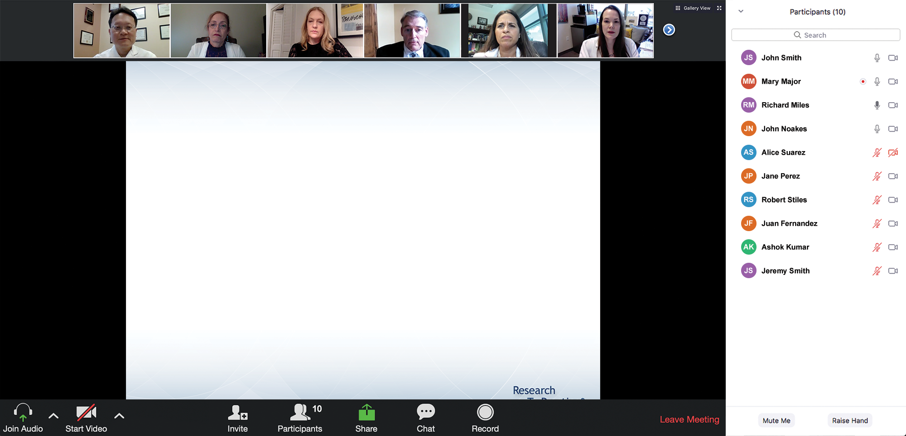
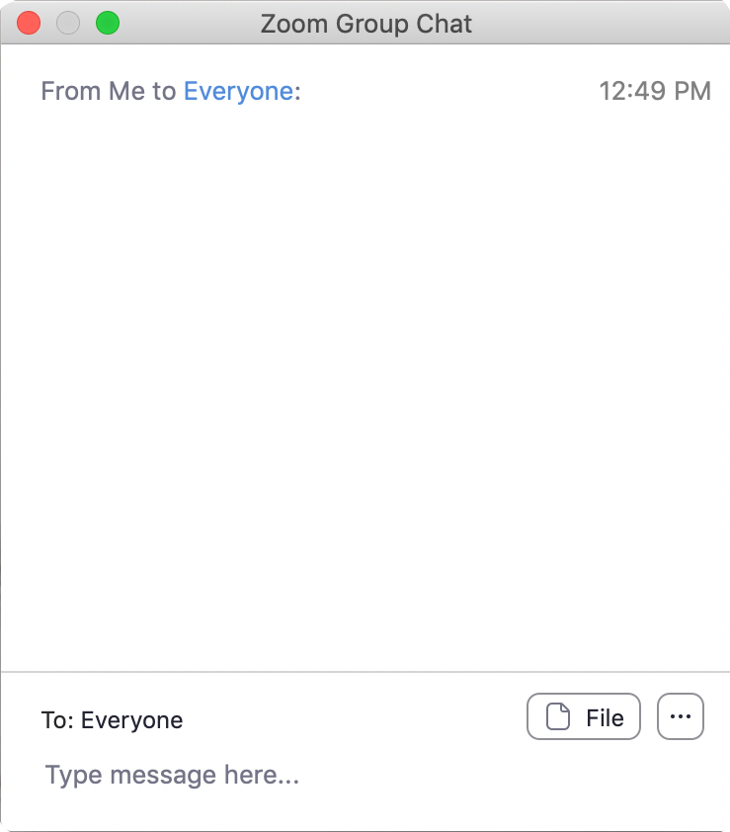
We Encourage Clinicians in Practice to Submit Questions
Feel free to submit questions now before the program begins and throughout the program.

Slide 10
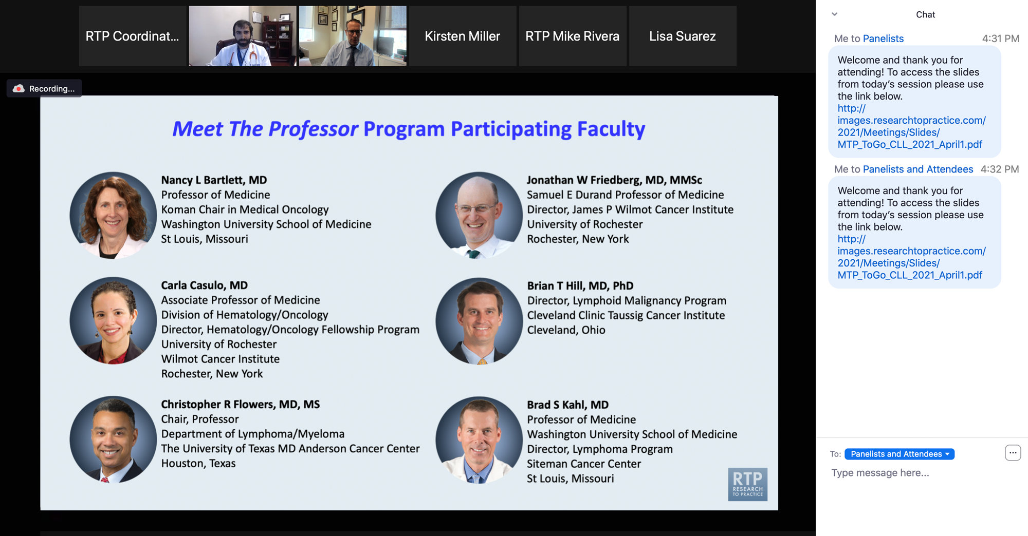
Familiarizing Yourself with the Zoom Interface
Expand chat submission box
Drag the white line above the submission box up to create more space for your message.

Slide 11
Familiarizing Yourself with the Zoom Interface
Increase chat font size
Press Command (for Mac) or Control (for PC) and the + symbol. You may do this as many times as you need for readability.

Slide 12
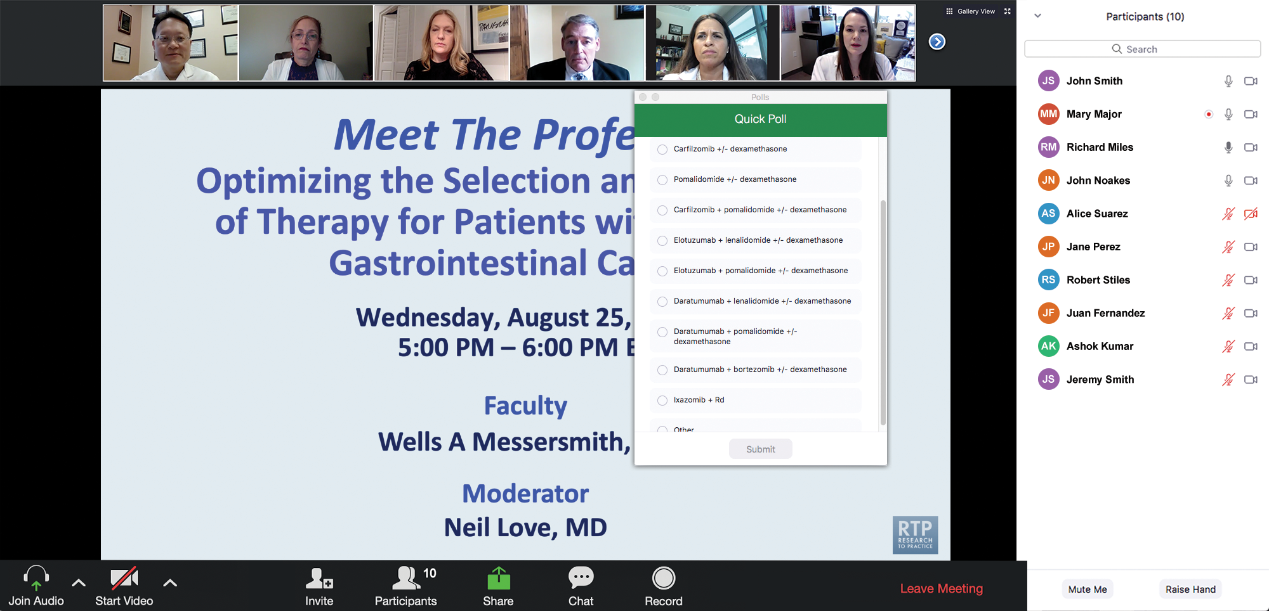
Clinicians in the Audience, Please Complete the Pre- and Postmeeting Surveys
Quick Survey
Quick Poll

Slide 14
Practical Perspectives: Experts Review Actual Cases of Patients with Small Cell Lung Cancer
A CME/MOC-Accredited Live Webinar
Wednesday, July 16, 2025 5:00 PM – 6:00 PM ET
Faculty
Stephen V Liu, MD
Charles Rudin, MD, PhD
Moderator
Neil Love, MD

Slide 15
Inside the Issue: Managing Ocular Toxicities Associated with Antibody-Drug Conjugates and Other Cancer Therapies
A CME/MOC-Accredited Live Webinar
Thursday,​ July 17, 2025 5:00 PM – 6:15 PM ET
Faculty
Rebecca A Dent, MD, MSc
Hans Lee, MD
Neel Pasricha, MD
Tiffany A Richards, PhD, ANP-BC, AOCNP
Moderator
Neil Love, MD

Slide 16
Cancer Q&A: Addressing Common Questions Posed by Patients with Relapsed/Refractory Multiple Myeloma
A Webinar Series for Clinicians and Patients, Developed in Partnership with CancerCare®
Patients
Clinicians
Wednesday, July 23, 2025
6:00 PM – 7:00 PM ET
Thursday, August 7, 2025
5:00 PM – 6:00 PM ET
Faculty
Natalie S Callander, MD
Sagar Lonial, MD, FACP
Moderator
Neil Love, MD

Slide 17
Addressing Current Knowledge and Practice Gaps in the Community — Optimizing the Use of Oral Selective Estrogen Receptor Degraders for Metastatic Breast Cancer
A CME/MOC-Accredited Live Webinar
Tuesday, July 29, 2025 5:00 PM – 6:00 PM ET
Faculty
Komal Jhaveri, MD, FACP
Virginia Kaklamani, MD, DSc
Moderator
Neil Love, MD

Slide 18
Practical Perspectives: Experts Review Actual Cases of Patients with Biliary Tract Cancers
A CME/MOC-Accredited Live Webinar
Wednesday, August 6, 2025 5:00 PM – 6:00 PM ET
Faculty
Haley Ellis, MD
James J Harding, MD
Moderator
Neil Love, MD

Slide 19
Thank you for joining us! Please take a moment to complete the survey currently up on Zoom. Your feedback is very important to us. Information on how to obtain CME and ABIM MOC credit will be provided at the conclusion of the activity in the Zoom chat room. Attendees will also receive an email in 1 to 3 business days with these instructions.

Slide 20
Optimizing the Selection of First-Line Therapy for Patients with Multiple Myeloma
A CME/MOC-Accredited Live Webinar
Tuesday,​ July 1, 2025 5:00 PM – 6:00 PM ET
Faculty
Xavier Leleu, MD, PhD Peter Voorhees, MD
Moderator
Neil Love, MD

Slide 21
Faculty
Xavier Leleu, MD, PhD
Professor, Head of Myeloma Clinic
Head of Department of Hematology
Hôpital La Miletrie
Poitiers University Hospital
Poitiers, France
MODERATOR
Neil Love, MD Research To Practice Miami, Florida
Peter Voorhees, MD
Professor of Medicine
Wake Forest University School of Medicine
Chief, Plasma Cell Disorders Division
Atrium Health/Levine Cancer Institute
Associate Director of Clinical Research
Atrium Health Wake Forest Baptist Comprehensive Cancer Center
Charlotte, North Carolina

Slide 22
We Encourage Clinicians in Practice to Submit Questions
Feel free to submit questions now before the program begins and throughout the program.

Slide 23
Clinicians in the Audience, Please Complete the Pre- and Postmeeting Surveys
Quick Survey
Quick Poll

Slide 25
Practical Perspectives: Experts Review Actual Cases of Patients with Small Cell Lung Cancer
A CME/MOC-Accredited Live Webinar
Wednesday, July 16, 2025 5:00 PM – 6:00 PM ET
Faculty
Stephen V Liu, MD
Charles Rudin, MD, PhD
Moderator
Neil Love, MD

Slide 26
Inside the Issue: Managing Ocular Toxicities Associated with Antibody-Drug Conjugates and Other Cancer Therapies
A CME/MOC-Accredited Live Webinar
Thursday,​ July 17, 2025 5:00 PM – 6:15 PM ET
Faculty
Rebecca A Dent, MD, MSc
Hans Lee, MD
Neel Pasricha, MD
Tiffany A Richards, PhD, ANP-BC, AOCNP
Moderator
Neil Love, MD

Slide 27
Cancer Q&A: Addressing Common Questions Posed by Patients with Relapsed/Refractory Multiple Myeloma
A Webinar Series for Clinicians and Patients, Developed in Partnership with CancerCare®
Patients
Clinicians
Wednesday, July 23, 2025
6:00 PM – 7:00 PM ET
Thursday, August 7, 2025
5:00 PM – 6:00 PM ET
Faculty
Natalie S Callander, MD
Sagar Lonial, MD, FACP
Moderator
Neil Love, MD

Slide 28
Addressing Current Knowledge and Practice Gaps in the Community — Optimizing the Use of Oral Selective Estrogen Receptor Degraders for Metastatic Breast Cancer
A CME/MOC-Accredited Live Webinar
Tuesday, July 29, 2025 5:00 PM – 6:00 PM ET
Faculty
Komal Jhaveri, MD, FACP
Virginia Kaklamani, MD, DSc
Moderator
Neil Love, MD

Slide 29
Practical Perspectives: Experts Review Actual Cases of Patients with Biliary Tract Cancers
A CME/MOC-Accredited Live Webinar
Wednesday, August 6, 2025 5:00 PM – 6:00 PM ET
Faculty
Haley Ellis, MD
James J Harding, MD
Moderator
Neil Love, MD

Slide 30
Optimizing the Selection of First-Line Therapy for Patients with Multiple Myeloma
A CME/MOC-Accredited Live Webinar
Tuesday,​ July 1, 2025 5:00 PM – 6:00 PM ET
Faculty
Xavier Leleu, MD, PhD Peter Voorhees, MD
Moderator
Neil Love, MD

Slide 31
Prof Leleu — Disclosures
Please refer to our website at https://www.researchtopractice.com/Webinars/First-LineTherapyMM/Jul1

Slide 32
Dr Voorhees — Disclosures
Advisory Committees | AbbVie Inc, Ascentage Pharma, AstraZeneca Pharmaceuticals LP, Bristol Myers Squibb, GSK, Johnson & Johnson, Kite, A Gilead Company, Pfizer Inc, Regeneron Pharmaceuticals Inc, Sanofi

Slide 33
Dr Love — Disclosures
Dr Love is president and CEO of Research To Practice. Research To Practice receives funds in the form of educational grants to develop CME activities from the following companies: Aadi Bioscience, AbbVie Inc, ADC Therapeutics, Alexion Pharmaceuticals, Amgen Inc, Array BioPharma Inc, a subsidiary of Pfizer Inc, Arvinas, Astellas, AstraZeneca Pharmaceuticals LP, Aveo Pharmaceuticals, Bayer HealthCare Pharmaceuticals, BeiGene Ltd, Black Diamond Therapeutics Inc, Blueprint Medicines, Boehringer Ingelheim Pharmaceuticals Inc, Bristol Myers Squibb, Clovis Oncology, Coherus BioSciences, CTI BioPharma, a Sobi Company, Daiichi Sankyo Inc, Eisai Inc, Elevation Oncology Inc, Exact Sciences Corporation, Exelixis Inc, Genentech, a member of the Roche Group, Genmab US Inc, Geron Corporation, Gilead Sciences Inc, GSK, Hologic Inc, ImmunoGen Inc, Incyte Corporation, Ipsen Biopharmaceuticals Inc, Jazz Pharmaceuticals Inc, Johnson & Johnson, Karyopharm Therapeutics, Kite, A Gilead Company, Kura Oncology, Legend Biotech, Lilly, MEI Pharma Inc, Merck, Mersana Therapeutics Inc, Mirati Therapeutics Inc, Mural Oncology Inc, Natera Inc, Novartis, Novartis Pharmaceuticals Corporation on behalf of Advanced Accelerator Applications, Novocure Inc, Nuvalent, Pfizer Inc, Pharmacyclics LLC, an AbbVie Company, Puma Biotechnology Inc, Regeneron Pharmaceuticals Inc, Rigel Pharmaceuticals Inc, R-Pharm US, Sanofi, Seagen Inc, Servier Pharmaceuticals LLC, SpringWorks Therapeutics Inc, Stemline Therapeutics Inc, Syndax Pharmaceuticals, Taiho Oncology Inc, Takeda Pharmaceuticals USA Inc, TerSera Therapeutics LLC, and Tesaro, A GSK Company.

Slide 34
Commercial Support
This activity is supported by educational grants from Johnson & Johnson and Sanofi.
Research To Practice CME Planning Committee Members, Staff and Reviewers
Planners, scientific staff and independent reviewers for Research To Practice have no relevant conflicts of interest to disclose.

Slide 35
This educational activity contains discussion of non-FDA-approved uses of agents and regimens. Please refer to official prescribing information for each product for approved indications.

Slide 36
Selection of First-Line Therapy and Maintenance Treatment for Patients with Multiple Myeloma
Introduction: Myeloma Time Capsule
Module 1: Smoldering Myeloma
Module 2: Autologous Stem Cell Transplant (ASCT) Eligible
Module 3: ASCT Ineligible
Module 4: Subcutaneous Anti-CD38 Antibodies
Module 5: Special Considerations

Slide 37
Clinical Investigator Survey Participants
Larry D Anderson Jr, MD, PhD
Jesús G Berdeja, MD
Natalie S Callander, MD
Rafael Fonseca, MD
Morie A Gertz, MD, MACP
Carol Ann Huff, MD
Amrita Krishnan, MD
Shaji K Kumar, MD
C Ola Landgren, MD, PhD
Hans Lee, MD
Xavier Leleu, MD, PhD
Thomas Martin, MD
María-Victoria Mateos, MD, PhD
Joseph Mikhael, MD, MEd
Professor Philippe Moreau, MD
Ajay K Nooka, MD, MPH
S Vincent Rajkumar, MD
Alexander K Stewart, MD
Sascha A Tuchman, MD, MHS
Peter Voorhees, MD

Slide 38
First Line Therapy for Multiple Myeloma
Peter Voorhees, M.D.
Professor of Medicine, Wake Forest University School of Medicine
Chief, Plasma Cell Disorders Division, Atrium Health / Levine Cancer Institute
Associate Director of Clinical Research, Atrium Health Wake Forest Baptist Comprehensive Cancer Center

Slide 39
Key Datasets
Peter Voorhees, MD
Dimopoulos MA et al. Phase 3 randomized study of daratumumab monotherapy versus active monitoring in patients with high-risk smoldering multiple myeloma: Primary results of the AQUILA study. ASH 2024;Abstract 773.
Dimopoulos et al. Daratumumab or active monitoring for high-risk smoldering multiple myeloma. N Engl J Med 2024;392(18):1777-88.
Voorhees PM et al. Addition of daratumumab to lenalidomide, bortezomib, and dexamethasone for transplantation-eligible patients with newly diagnosed multiple myeloma (GRIFFIN): Final analysis of an open-label, randomised, phase 2 trial. Lancet Haematol 2023;10:e825-37.
Sonneveld P et al. Daratumumab, bortezomib, lenalidomide, and dexamethasone for multiple myeloma. New Engl J Med 2024;390:132-47.
Dimopoulos M et al. Daratumumab (DARA)/bortezomib/lenalidomide/dexamethasone (D‐VRd) with D‐R maintenance (Maint) in transplant‐eligible (TE) newly diagnosed myeloma (NDMM): PERSEUS cytogenetic risk analysis. International Myeloma Society (IMS) 2024;Abstract OA-48.
Goldschmidt H et al. Impact of minimal residual disease on progression-free survival in patients with newly diagnosed multiple myeloma treated with isatuximab, lenalidomide, bortezomib and dexamethasone induction therapy in the Phase 3 GMMG-HD7 trial. ASH 2024;Abstract 364.
Gay F et al. Sustained MRD negativity in patients with newly diagnosed multiple myeloma treated with carfilzomib-lenalidomide-dexamethasone with or without isatuximab (phase III IsKia trial). ASCO 2025;Abstract 7502.

Slide 40
Key Datasets
Peter Voorhees, MD (continued)
Gay F et al. Analysis of sustained MRD negativity in patients with newly diagnosed multiple myeloma treated with carfilzomib-lenalidomide-dexamethasone with or without isatuximab (Phase III ISKIA trial). EHA 2025;Abstract S208.
Badros A et al. Daratumumab with lenalidomide as maintenance after transplant in newly diagnosed multiple myeloma: The AURIGA study. Blood 2025;145(3):300-10.
Foster L et al. Daratumumab plus lenalidomide (D-R) versus lenalidomide (R) alone as maintenance therapy in newly diagnosed multiple myeloma (NDMM) after transplant: Analysis of the phase 3 AURIGA study among clinically relevant subgroups. ASH 2024;Abstract 675.
Moreau P et al. Daratumumab (DARA) + bortezomib/thalidomide/dexamethasone (D-VTD) followed by DARA maintenance in transplant-eligible (TE) newly diagnosed multiple MYELOMA (NDMM): >6-year update of CASSIOPEIA. EHA 2024;Abstract S204.
Moreau P et al. Bortezomib, thalidomide, and dexamethasone with or without daratumumab and followed by daratumumab maintenance or observation in transplant-eligible newly diagnosed multiple myeloma: Long-term follow-up of the CASSIOPEIA randomised controlled phase 3 trial. Lancet Oncol 2024;25(8):1003-14.
Callander N et al. Daratumumab-based quadruplet therapy for transplant-eligible newly diagnosed multiple myeloma with high cytogenetic risk. Blood Cancer J 2024;14(1):69.
Perrot A et al. MRD-driven strategy following IsaKRD induction in transplant-eligible NDMM: Primary endpoints of the phase 3 MIDAS trial. ASCO 2025;Abstract 7500.

Slide 41
Key Datasets
Peter Voorhees, MD (continued)
Perrot A et al. Minimal residual disease-driven strategy following isatuximab-carfilzomib-lenalidomide-dexamethasone induction in transplant-eligible newly diagnosed multiple myeloma: Primary endpoints of the phase 3 MIDAS trial. EHA 2025;Abstract S205.
Usmani S et al. Daratumumab plus bortezomib, lenalidomide and dexamethasone for transplant-ineligible or transplant-deferred newly diagnosed multiple myeloma: The randomized phase 3 CEPHEUS trial. Nature Med 2025;31(4):1195-202.
Facon T et al. Isatuximab, bortezomib, lenalidomide, and dexamethasone for multiple myeloma. New Engl J Med 2024;391:1597-609.
Leleu X et al. Isatuximab, lenalidomide, dexamethasone and bortezomib in transplant-ineligible multiple myeloma: The randomized phase 3 BENEFIT trial. Nat Med 2024;30:2235-41.
Manier S et al. Phase 3 study results of isatuximab, bortezomib, lenalidomide, and dexamethasone (Isa‐VRd) versus VRd for transplant‐ineligible patients with newly diagnosed multiple myeloma (IMROZ). IMS 2024;Abstract OA-49.
Ailawadhi S et al. Isatuximab subcutaneous by on-body injector versus isatuximab intravenous plus pomalidomide and dexamethasone in relapsed/refractory multiple myeloma: Phase III IRAKLIA study. J Clin Oncol 2025;[Online ahead of print].
Leleu X et al. Isatuximab subcutaneous via an on-body delivery system versus isatuximab intravenous, plus pomalidomide and dexamethasone, in relapsed/refractory multiple myeloma: The randomized phase 3 IRAKLIA study. EHA 2025;Abstract S203.

Slide 42
Selection of First-Line Therapy and Maintenance Treatment for Patients with Multiple Myeloma
Introduction: Myeloma Time Capsule
Module 1: Smoldering Myeloma
Module 2: Autologous Stem Cell Transplant (ASCT) Eligible
Module 3: ASCT Ineligible
Module 4: Subcutaneous Anti-CD38 Antibodies
Module 5: Special Considerations

Slide 43
Case Presentation – Dr Voorhees: 78-year-old man with smoldering myeloma
78-year-old man who was screened for a clonal plasma cell disorder as part of a work-up of cardiac amyloidosis.
CBC, Cr, Ca normal. SPEP/IFE: Monoclonal IgG kappa 2.2 g/dL, serum free kappa LCs 290 mg/L, FLC ratio 31.66.
Bone marrow: 40% PCs. Myeloma FISH: + for gain 1q21 and +9.
Endomyocardial biopsy + for wild type TTR amyloidosis.
Imaging: PET-CT and MRI of the C/T/L spine with no lesions.
Co-morbidities: Diastolic heart failure (compensated),atrial fibrillation, neuropathic pain in the distal lower extremities from lumbar spine stenosis.
Repeat myeloma markers 1-year into active monitoring: SPEP/IFE: Monoclonal IgG kappa 2.5 g/dL, serum free kappa LCs 312 mg/L, FLC ratio 39.7.
ECOG PS 1
To treat or not to treat?

Slide 44
Case Presentation – Dr Voorhees: 78-year-old man with smoldering myeloma (cont’d)
After a discussion of the risks / benefits of treatment, we agreed to move forward with daratumumab monotherapy as treatment.
The patient had some exacerbation of edema and dyspnea with exertion after the first 2 doses of daratumumab that we attributed to the corticosteroid premedication. After omission of dexamethasone from cycle 1, day 15 and beyond, the patient has had essentially no side effects. The M spike has achieved a partial response to therapy.
We intend to stop treatment after 36 months.

Slide 45
Selection of First-Line Therapy and Maintenance Treatment for Patients with Multiple Myeloma
Introduction: Myeloma Time Capsule
Module 1: Smoldering Myeloma
Module 2: Autologous Stem Cell Transplant (ASCT) Eligible
Module 3: ASCT Ineligible
Module 4: Subcutaneous Anti-CD38 Antibodies
Module 5: Special Considerations

Slide 46
Regulatory and reimbursement issues aside, if you were going to offer systemic treatment to a 65-year-old patient with high-risk smoldering myeloma, what would you most likely recommend?
Dara
10
Dara-RVd
3
Dara-Rd
1
Dara or R
1
I would not recommend therapy
2
Other*
3
* Only on a clinical trial; full MM therapy; first-line therapy as in MM trials

Slide 47
For which clinical situations, if any, would you offer systemic treatment to a 65-year-old patient with high-risk smoldering myeloma?
If evidence of disease progression or evolving to MM
6
All patients
4
Patient preference
3
On clinical trial only
4
If comorbidities make 3- or 4-drug combination not feasible
1
None
2

Slide 48
Regulatory and reimbursement issues aside, if you were going to offer systemic treatment to an 80-year-old patient with high-risk smoldering myeloma, what would you most likely recommend?
Dara
15
Dara-Rd
2
Dara or R
1
Isa-Rd
1
Other*
1
* Only on a clinical trial

Slide 49
For which clinical situations, if any, would you offer systemic treatment to an 80-year-old patient with high-risk smoldering myeloma?
All or most patients
8
If evidence of disease progression or evolving to MM
5
Patient preference
3
If comorbidities make 3- or 4-drug combination not feasible
1
On clinical trial only
1
None
2

Slide 50
Daratumumab vs Observation for High-Risk Smoldering Myeloma: The Phase III AQUILA Trial
3 years of SC dara vs observation
Clonal BMPCs ≥10% and ≥1 of the following risk factors: 1) Serum M-protein ≥30 g/L; 2) IgA SMM; 3) Immunoparesis with reduction of 2 uninvolved Ig isotypes; 4) Serum involved:uninvolved FLC ratio ≥8 and <100; 5) Clonal BMPCs >50% to <60%
ECOG PS 0 - 1
Primary Endpoint: Death or progression to active myeloma (SLiM / CRAB)
Median follow-up: 65.2 months
 | DARA (n = 194) | Active monitoring (n = 196)
PFS event, n (%) | 67 (34.5) | 99 (50.5)
Death without disease progression | 5 (2.6) | 5 (2.6)
Disease progressionª | 62 (32.0) | 94 (48.0)
CRAB criteria | 12 (6.2) | 34 (17.3)
Calcium elevation | 0 | 2 (1.0)
Renal insufficiency^{b} | 0 | 0
Anemia | 2 (1.0) | 14 (7.1)
Bone disease | 10 (5.2) | 18 (9.2)
SLiM criteria | 50 (25.8) | 65 (33.2)
Clonal BMPCs | 5 (2.6) | 16 (8.2)
Serum FLC | 33 (17.0) | 33 (16.8)
Focal lesion by MRI | 12 (6.2) | 16 (8.2)
100
79.9%
Daratumumab Median: not reached
80
63.3%
60
Percentage of patients surviving without disease progression
63.1%
40
HR, 0.49 (95% CI, 0.36-0.67) P <0.001
Active monitoring Median: 41.5 months
40.8%
20
DARA treatment
0
0
3
6
9
12
15
18
21
24
27
30
33
36
39
42
45
48
51
54
57
60
63
66
69
72
No. at risk
Months since randomization
Daratumumab
194
188
181
179
166
156
149
145
142
139
138
135
129
121
118
114
106
102
99
96
90
67
41
17
6
Active monitoring
196
180
175
160
142
131
120
111
100
91
87
83
78
71
67
65
60
55
51
50
49
33
19
8
2
HR, hazard ratio; CI, confidence interval. ªA patient may show disease progression based on ≥1 criterion. ^{b}Some patients met the CRAB criteria for renal insufficiency, but the investigator attributed this to a cause other than disease progression to MM. Adapted with permission © The New England Journal of Medicine (2024).
Dimopoulos MA et al. ASH 2024; Dimopoulos et al. N Engl J Med 2024.
Courtesy of Peter Voorhees, MD

Slide 51
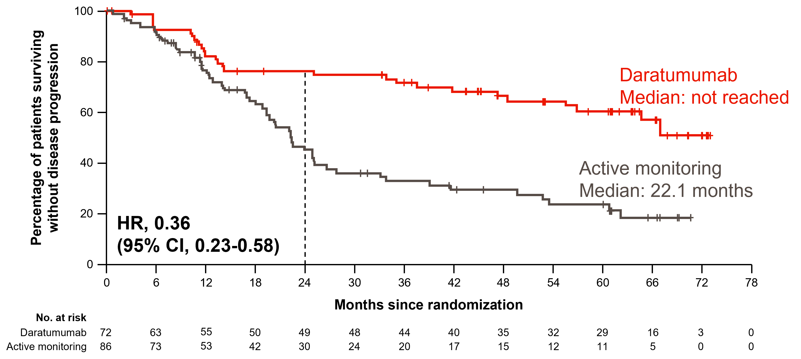
Daratumumab Monotherapy for High-Risk Smoldering Myeloma: The 20 / 2 / 20 Criteria
Dimopoulos MA et al. ASH 2024.
Courtesy of Peter Voorhees, MD

Slide 52
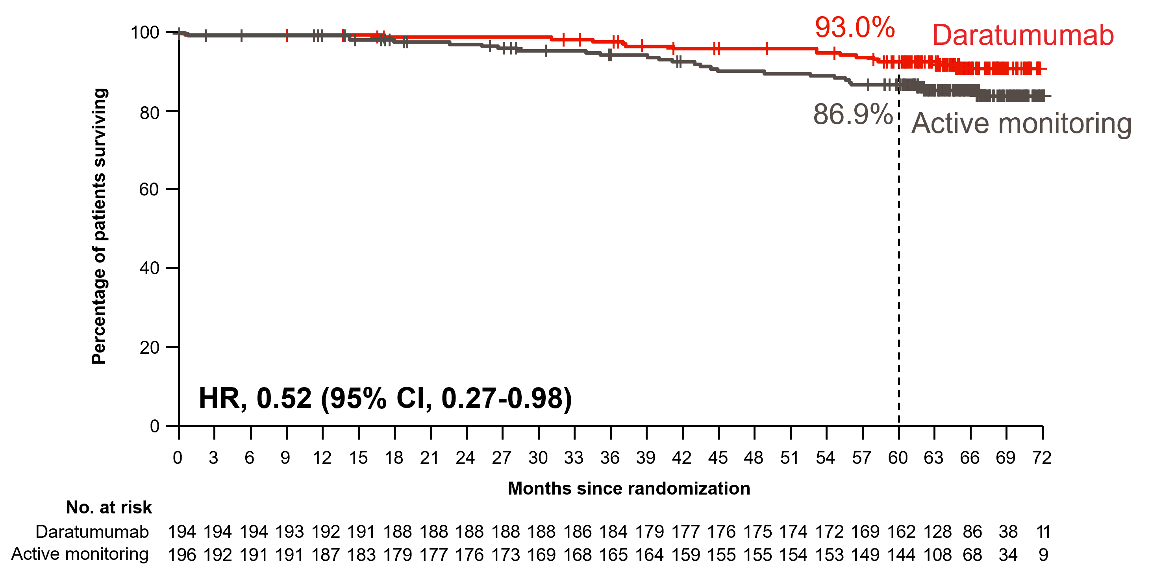
Overall Survival: AQUILA
 | DARA (n = 194) | Active monitoring (n = 196)
Deaths, n (%) | 15 (7.7) | 26 (13.3)
Primary cause, n
Disease progression | 3 | 9
AE | 2 | 4
Other* | 10 | 13
*Deaths due to an event occurring after the AE reporting window (ie, events that happened after patient started subsequent therapy or >30 days after last dose) or deaths with unknown reason.
Dimopoulos MA et al. ASH 2024; Dimopoulos et al. N Engl J Med 2024.
Courtesy of Peter Voorhees, MD

Slide 53
Selection of First-Line Therapy and Maintenance Treatment for Patients with Multiple Myeloma
Introduction: Myeloma Time Capsule
Module 1: Smoldering Myeloma
Module 2: Autologous Stem Cell Transplant (ASCT) Eligible
Module 3: ASCT Ineligible
Module 4: Subcutaneous Anti-CD38 Antibodies
Module 5: Special Considerations

Slide 54
Case Presentation – Prof Leleu: 63-year-old transplant-eligible patient with multiple myeloma (MM)
Male, 63 years old, fit, doing sports on a regular basis.
Almost never has seen a physician in his adult life besides general practitioner for vaccinations. No regular medications.
Started having lower back pains a year ago approximately. Thought initially it was either related to sport or some gain of weight. The pain intensified moderately, and the patient asked for anti-inflammatory pain killers or a checkup for discal hernia. The general practitioner recommended a lumbar column radiography before any other imagery and some labs tests.
Radiography. Possible lytic lesion on L4 and L5.
Bio test. Hb 10.5 g/dL, WBC and Plat normal values. Clearance creatinine and calcium normal. Protidemia 110 g/L.
The biology lab added a serum protein electrophoresis given the hyperprotidemia. Showed hypergammaglobulinemia of monoclonal type. Then it was confirmed on immunofixation, IgG K isotype.
Urine test requested, that was normal. Serum calcium, ionogram, liver enzymes’ values were in normal ranges.
Patient was sent over to Hematology for consultation as Myeloma is suspected.
Hematology department. Education on MM was done, and extra labs and imagery performed, including PET CT (multiple lytic lesions with hypermetabolisms, no PMD and EMD, careful L4 and L5 are very unstable), labs for prognostication, MM confirmation + NGS genomic. ISS 2. RISS 2. Serum LDH level normal. No plasmablastic features. No CTC on CBC.

Slide 55
Case Presentation – Prof Leleu: 63-year-old transplant-eligible patient with MM (cont’d)
As a conclusion. NDMM SLiM CRAB on bone and sFLC ratio (ratio 110). Non HR, patient hyperdiploid, isolated t11;14+. 63 fit TE. ECOG 1.
Line 1.
DVRd was given as the standard of care according to PERSEUS study
V twice weekly, R 25 mg 21/28, dexa 20 mg
+ supportive care, Bisphosphonate x 4 cycles, vaccination +++ (flu, covid, pneumonia)
x 3 cycles
Patient experienced grade 1 neuropathy
VGPR
Was collected for 1 transplantation
x 3 more cycles but with V weekly
Patient grade 1 neuropathy
sCR
Patient transplanted with HDM 200 mg/m2

Slide 56
Case Presentation – Prof Leleu: 63-year-old transplant-eligible patient with MM (cont’d)
3 months later (day 100 from graft infusion), patient started DR no dexa as maintenance.
Objective to try to give for a minimum of 2 years then see.
At 2 years, patient decided to stop TTT and was on watch and wait.
5 years from diagnosis = CR and doing great.
Neuropathy persists grade 1.

Slide 57
Case Presentation – Dr Voorhees: 57-year-old transplant-eligible patient with MM
57-year-old woman who presented with symptomatic bone disease, anemia, hypercalcemia and acute renal failure.
Hgb 8.5 g/dL, Ca 14.8, albumin 3.2, Cr 1.56, LDH normal, B2M 9.7, SPEP/IFE: Monoclonal IgG kappa 4.8 g/dL, serum free kappa LCs 6749 mg/L, FLC ratio 2045.
Bone marrow: 80% PCs. Myeloma FISH: + for del 1p32, -13 and loss of IgH.
Imaging: PET-CT with innumerable FDG avid lytic bone lesions.
Co-morbidities: Hyperlipidemia.
ECOG PS 2 due to bone pain.

Slide 58
Case Presentation – Dr Voorhees: 57-year-old transplant-eligible patient with MM (cont’d)
The patient was placed on D-VRd induction therapy. Due to the early emergence of symptomatic neuropathy, the bortezomib was replaced with carfilzomib during cycle 2. The patient received 4 cycles of induction therapy to which she achieved an MRD+ very good partial response followed by an upfront ASCT to which she achieved an MRD negative complete response. She has since received 2 cycles of post-ASCT consolidation with D-KRd and is now on lenalidomide and daratumumab maintenance.

Slide 59
Regulatory and reimbursement issues aside, what is your preferred induction regimen for a 65-year-old transplant-eligible patient with standard-risk MM?
Dara-RVd
17
Dara-KRd
2
Isa-RVd
1
What maintenance therapy would you recommend if the post-transplant measurable residual disease (MRD) status were …
Positive?
Negative?
Dara-R
14
Dara-R
9
R alone
3
R alone
10
Dara-VR
1
Dara-VR
0
Dara-R then R alone
1
Dara-R then R alone
0
BCMA-targeted therapy
1*
BCMA-targeted therapy* or anti-CD38 monoclonal antibody
1
* Bispecific antibody or CAR T-cell therapy

Slide 60
How long would you continue maintenance therapy for a 65-year-old transplant-eligible patient with standard-risk MM?
2 years
3
3 years
2
Indefinitely
13
Depends on MRD status
2

Slide 61
In general, what is your approach to autologous stem cell transplant (ASCT) for patients with standard-risk MM?
Early ASCT
9
Delayed ASCT
2*
Patient preference for early vs delayed
9
* If MRD-negative and not high risk
Does your approach to ASCT differ for African American patients with MM?
Yes
1
No
19

Slide 62
Regulatory and reimbursement issues aside, what is your preferred induction regimen for a 65-year-old transplant-eligible patient with high-risk (eg, del[17p]) MM?
Dara-RVd
10
Dara-KRd
7
Dara/Isa-RVd
2
Dara/Isa-KRd
1
What maintenance therapy would you recommend if the post-transplant MRD status were …
Positive?
Negative?
Dara-R
6
Dara-R
7
Dara-KR
2
Dara-KR
2
Dara-RV
1
Dara-RV
1
Dara/Isa-KRd
1
Dara/Isa-KRd
0
Dara-RVd
1
Dara-RVd
0
Dara-KPomd then Pom alone
1
Dara-KPomd then Pom alone
0
Dara-Pomd
1
Dara-Pomd
1
K-Pomd then Pom alone
0
K-Pomd then Pom alone
1
VR
4
VR
4
VR or KR
1
VR or KR
1
KR
0
KR
1
KR then R alone
1
KR then R alone
1
BCMA-targeted bispecific antibody
1
BCMA-targeted bispecific antibody
1

Slide 63
How long would you continue maintenance therapy for a 65-year-old transplant-eligible patient with high-risk (eg, del[17p]) MM?
2 years
1
3 years
2
Indefinitely
15
Depends on MRD status
2

Slide 64
In general, what is your approach to ASCT for patients with high-risk (eg, del[17p]) MM?
Early ASCT
18
Patient preference for early vs delayed
2

Slide 65
From your perspective, at this time should community-based general medical oncologists be assessing MRD to guide clinical decisions regarding induction and/or maintenance therapy?
Yes, for maintenance treatment
7
Yes, for induction and maintenance treatment
4
No
9

Slide 66
Which type or types of MRD assay should be ordered?
Next-generation sequencing (NGS)
7
NGS or next-generation flow
3
Flow cytometry
1
n = 11
At what intervals during the treatment course should an MRD assay be ordered?
6 to 12 months
1
Yearly
5
Yearly for 2 years
1
One to 2 years on maintenance
1
Yearly if negative, every 6 months if positive
1
Yearly in general, but more frequent at beginning
1
When considering maintenance discontinuation
1
n = 11

Slide 67
Daratumumab / IMiD / PI Quadruplets + Upfront Autologous Stem Cell Transplantation in Newly Diagnosed Myeloma
Randomized phase II (GRIFFIN) and phase III (PERSEUS) studies of VRd ± daratumumab (4 cycles induction, 2 cycles post-transplant consolidation) → ASCT → lenalidomide ± daratumumab maintenance (GRIFFIN: 2 years of daratumumab maintenance; PERSEUS: 2 years of daratumumab maintenance if CR and MRD- for ≥1 year)
GRIFFIN
PERSEUS
DVRd
DVRd
VRd
4-Yr PFS: DVRd: 84.3%; VRd 67.7%
VRd
Progression-Free Survival
Progression-Free Survival
HR 0.45 (95% CI 0.21 – 0.95, P = 0.032)
HR 0.42 (95% CI 0.30 – 0.59, P = 0.0001)
Voorhees PM et al. Lancet Haematol 2023;10:e825-e837.
Sonneveld P et al. New Engl J Med 2024;390:132-147
Courtesy of Peter Voorhees, MD

Slide 68
Daratumumab / IMiD / PI Quadruplets + Upfront Autologous Stem Cell Transplantation in High-Risk Patients: PERSEUS
100
D-VRd revised standard risk
80
VRd revised standard risk
D-VRd revised high risk
60
Surviving without progression, %
VRd revised high risk
40
20
0
0
3
6
9
12
15
18
21
24
27
30
33
36
39
42
45
48
51
54
Months
No. at risk
VRd revised standard risk |  | 167 | 157 | 152 | 148 | 143 | 141 | 140 | 138 | 137 | 135 | 131 | 127 | 123 | 118 | 116 | 96 | 36 | 6 | 0
D-VRd revised standard risk |  | 174 | 167 | 163 | 162 | 162 | 162 | 159 | 158 | 157 | 155 | 155 | 155 | 155 | 153 | 149 | 124 | 52 | 7 | 0
VRd revised high risk |  | 148 | 139 | 132 | 129 | 127 | 123 | 118 | 112 | 109 | 105 | 98 | 92 | 87 | 84 | 77 | 64 | 22 | 4 | 0
D-VRd revised high risk |  | 130 | 127 | 121 | 117 | 115 | 111 | 110 | 109 | 107 | 105 | 101 | 99 | 96 | 94 | 90 | 76 | 31 | 2 | 0
ªRevised standard risk: none of del(17p), t(4;14), t(14;16), amp(1q21), or gain(1q21). Revised high risk: ≥1 of del(17p), t(4;14), t(14;16), amp(1q21), or gain(1q21).
Dimopoulos MA et al. IMS 2024.
Courtesy of Peter Voorhees, MD

Slide 69
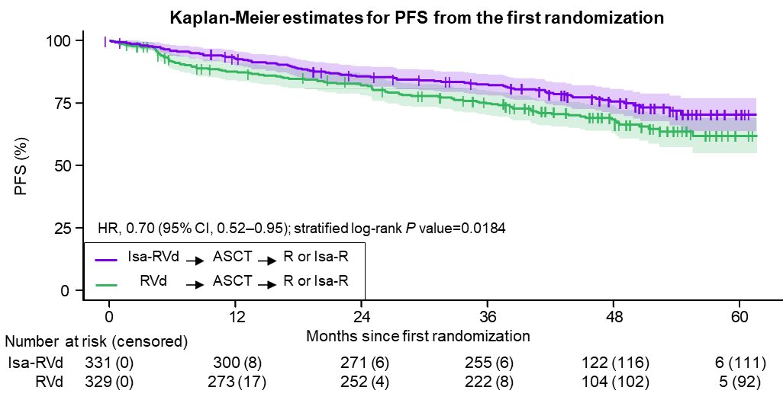
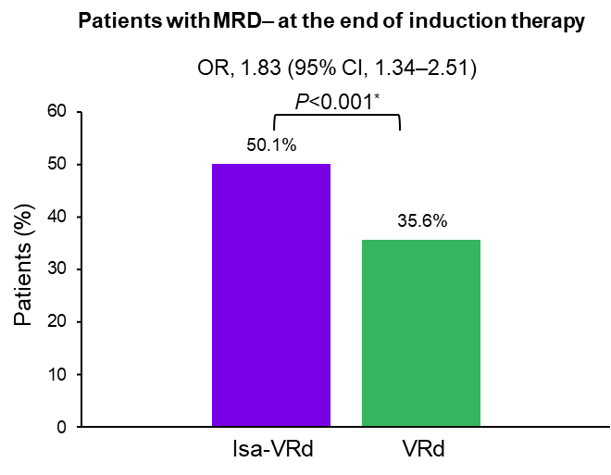
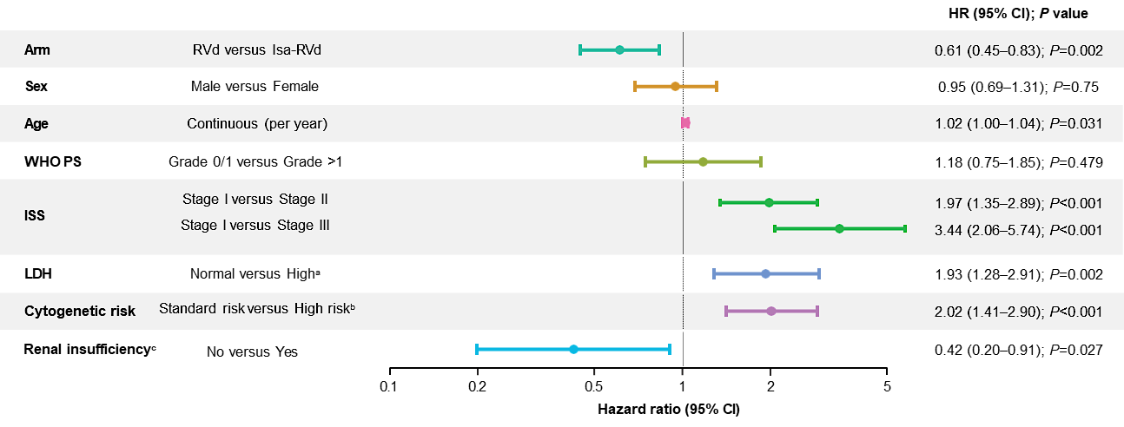
Isatuximab / IMiD / PI Quadruplets + Upfront Autologous Stem Cell Transplantation in Newly Diagnosed Myeloma: GMMG-HD7
Phase III study of VRd ± Isa x 6 cycles → ASCT for patients with NDMM
Randomization #1: VRd vs Isa-VRd
Randomization #2: R vs Isa-R maintenance
Goldschmidt H et al. ASH 2024.
Courtesy of Peter Voorhees, MD

Slide 70
Isatuximab / IMiD / PI Quadruplets + Upfront Autologous Stem Cell Transplantation in Newly Diagnosed Myeloma: IsKia
Phase III study of KRd ±Isa x 4 cycles → ASCT → KRd ±Isa x 4 cycles → KRd-light ±Isa x 12 cycles
Sustained MRD Negativity ≥1 Year (10⁻⁶)
Gay F et al. ASCO 2025; Gay F et al. EHA 2025.
Courtesy of Peter Voorhees, MD

Slide 71
CD38 Monoclonal Antibody-Based Maintenance Therapy

Slide 72
Lenalidomide ± Daratumumab as Maintenance Therapy for MRD+ / CD38 mAb-Naïve Patients Post-ASCT: AURIGA
Key eligibility criteria
18-79 years of age
NDMM with ≥4 cycles of induction therapy and underwent ASCT within 12 months of the start of induction
≥VGPR at screeningª
MRD^{b} positive (10^{–5}) post-ASCT
No prior anti-CD38
Randomization within 6 months of ASCT date
Stratification factor
Cytogenetic risk^{c} (standard risk/unknown vs high risk)
Maintenance: up to 36 cycles^{d} (28-day cycles)
Primary endpoint
MRD-negative (10^{–5}) conversion rate from baseline to 12 months after maintenance treatment
N = 214 planned to achieve ≥85% power to detect 20% improvement
Secondary endpoints
PFS, overall MRD-negative conversion rate, sustained MRD-negative rate, response rates, duration of ≥CR, OS, safety
D-R
D: 1,800 mg SCe QW Cycles 1-2, Q2W Cycles 3-6, Q4W Cycles 7+
R: 10 mg PO daily Days 1-28
(after Cycle 3, 15 mg PO daily if tolerated)
1:1 randomization (N = 200)
R
R: 10 mg PO daily Days 1-28
(after Cycle 3, 15 mg PO daily if tolerated)
MRD^{b} obtained after 12, 18, 24, and 36 cycles
VGPR, very good partial response; D, daratumumab; SC, subcutaneous; QW, weekly; Q2W, every 2 weeks; Q4W, every 4 weeks; PO, orally; CR, complete response. ªAs assessed by International Myeloma Working Group 2016 criteria. ^{b}MRD based upon NGS (clonoSEQ®; Adaptive Biotechnologies). ^{c}For stratification, cytogenetic risk was evaluated per investigator assessment, in which high risk was defined as the presence of ≥1 of the following cytogenetic abnormalities: del[17p], t[4;14], or t[14;16]. ^{d}Study treatment continued for a planned maximum duration of 36 cycles or until progressive disease, unacceptable toxicity, or withdrawal of consent. After the end of the study treatment period of 36 months and after the end of the study, patients benefiting from treatment with DARA and/or R could continue receiving treatment per the investigator’s discretion. ^{e}DARA SC (DARA 1,800 mg co-formulated with recombinant human hyaluronidase PH20 [rHuPH20; 2,000 U/mL; ENHANZE® drug delivery technology; Halozyme, Inc., San Diego, CA, USA]).
Badros A et al. IMS 2024.
Courtesy of Peter Voorhees, MD

Slide 73
MRD: AURIGA
Primary endpoint
OR^{b}: 4.62
(95% CI, 2.20-9.70)
P <0.0001^{c}
OR^{b}: 4.40
(95% CI, 2.26-8.58)
P <0.0001^{c}
OR^{b}: 4.51
(95% CI, 2.37-8.57)
P <0.0001^{c}
OR^{b}: 4.61
(95% CI, (2.34-9.09)
P <0.0001^{c}
Patients with MRD negativity, %
D-R
(50/99)
R
(19/101)
D-R
(46/75)
R
(16/62)
D-R
(50/88)
R
(19/82)
D-R
(44/99)
R
(15/101)
ITT population^{d}
Patients achieving ≥CR at any time^{e}
MRD-evaluable population^{f}
ITT population^{d}
MRD-negative (10^{‒5}) conversion rate by 12 months
MRD-negative (10^{‒5}) ≥CR conversion rate by 12 months^{g}
OR, odds ratio; CI, confidence interval. ªDefined as the proportion of patients who achieved MRD-negative status (at 10^{–5}) by NGS by 12 months after maintenance treatment and prior to progressive disease or subsequent antimyeloma therapy. ^{b}Mantel–Haenszel estimate of the common OR for stratified tables was used. The stratification factor was baseline cytogenetic risk per investigator assessment (high vs standard/unknown), as used for randomization. An OR >1 indicates an advantage for D-R. ^{c}P <0.0001 from Fisher’s exact test. ^{d}ITT analysis set is defined as all patients who were randomized to treatment. ^{e}Patients who achieved ≥CR at any time during the study per International Myeloma Working Group computerized algorithm. ^{f}MRD-evaluable analysis set included all randomized patients who had an MRD assessment at baseline and had ≥1 post-baseline MRD evaluation. ^{g}Defined as the proportion of patients who achieved ≥CR response and had MRD negative status (at 10⁻⁵) by NGS by 12 months after maintenance and prior to progressive disease and subsequent anti-myeloma therapy.
Badros A et al. IMS 2024.
Courtesy of Peter Voorhees, MD

Slide 74
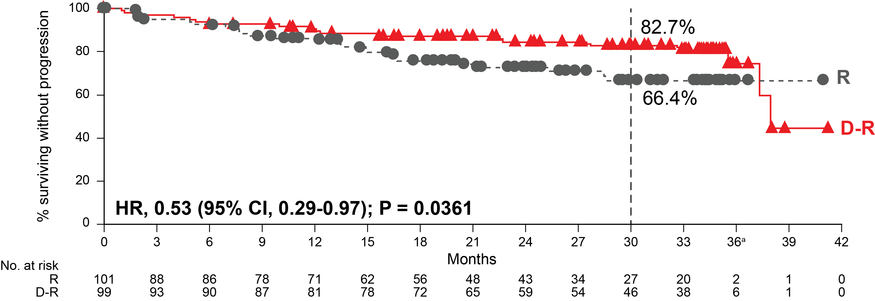
Progression-Free Survival: AURIGA
Median follow-up: 32.3 months
HR, hazard ratio. ªPer study protocol, disease assessments stopped at the end of study treatment (Cycle 36), after which patients were only followed for survival. At the time of this analysis, the number of patients who reached end of study treatment was low, thus resulting in a low number of patients at risk.
Badros A et al. IMS 2024; Badros A et al. Blood 2025.
Courtesy of Peter Voorhees, MD

Slide 75
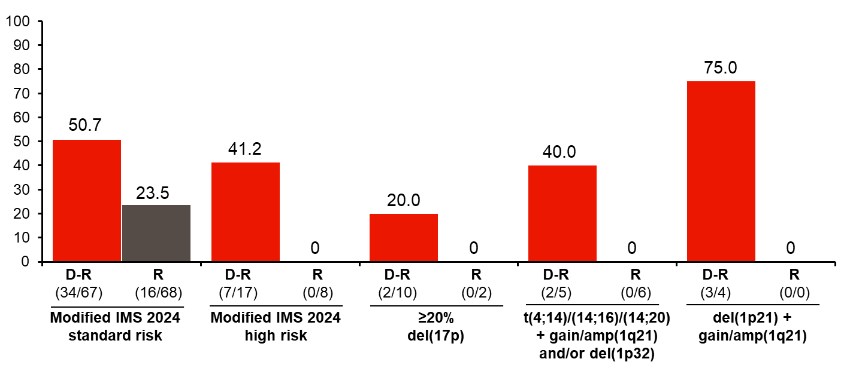
AURIGA in Standard- vs High-Risk Patients
Courtesy of Peter Voorhees, MD
Foster L et al. ASH 2024.

Slide 76
Lenalidomide ± Daratumumab as Maintenance Therapy for High-Risk Myeloma: AURIGA
ªHigh-risk cytogenetics per the standard definition are defined as ≥1 abnormality including del(17p), t(4;14), or t(14;16). ^{b}Revised high-risk cytogenetics per the revised definition are defined as ≥1 abnormality including del(17p), t(4;14), t(14;16), t(14;20), or gain/amp(1q21). ^{c}High risk per the modified IMS 2024 criteria is defined as the presence of ≥20% del(17p); or the association of ≥2 of the following: t(4;14) or t(14;16) or t(14;20); gain/amp(1q21); or del(1p32) [in the AURIGA study, data were not available on TP53 mutations, baseline ß2M, and creatinine levels and differentiation between monoallelic versus biallelic del(1p32)]. ^{d}HR and 95% CI from a Cox proportional hazards model with treatment as the sole explanatory variable. A HR <1 indicates an advantage for D-R.
Foster L et al. ASH 2024.
Courtesy of Peter Voorhees, MD

Slide 77
CD38 mAbs in Induction / Post-Transplant Consolidation vs Maintenance: CASSIOPEIA
Phase III study of randomization #1: VTd ± daratumumab (4 cycles induction, ASCT, 2 cycles post-transplant consolidation) → randomization #2: Observation vs daratumumab maintenance x 2 years
Moreau P et al. EHA 2024; Moreau P et al. Lancet Oncol 2024.
Courtesy of Peter Voorhees, MD

Slide 78
MRD-Adapted Therapy

Slide 79
CD38 mAb / IMiD / PI Quadruplets in High-Risk Myeloma: A MASTER and GRIFFIN Subset Analysis
MASTER
MASTER
4 cycles of Dara-KRd → ASCT → 4 cycles of Dara-KRd → 4 cycles of Dara-KRd → Len maintenance
MRD assessment after completion of each cassette of therapy
Transition to observation with 2 consecutive MRD negative readouts at 10⁻⁵
Progression-Free Survival
Isa-VRd
GRIFFIN
4 cycles of Dara-VRd → ASCT → 2 cycles of Dara-VRd → 2 years of Dara-len maintenance → Len maintenance
GRIFFIN
Progression-Free Survival
Courtesy of Peter Voorhees, MD
Callander N et al. Blood Cancer J 2024;22:69.

Slide 80
MRD-Adapted Consolidation after Isatuximab-KRd Induction: MIDAS
Phase III study of MRD-adapted therapy after 6 cycles of Isa-KRd induction therapy
MRD negative consolidation: Isa-KRd x 6 cycles vs ASCT + Isa-KRd x 2 cycles
MRD positive consolidation : Tandem ASCT vs single ASCT + Isa-KRd x 2 cycles
MRD Negativity Before and After Consolidation (10⁻⁶)
Perrot A et al. ASCO 2025; Perrot A et al. EHA 2025.
Courtesy of Peter Voorhees, MD

Slide 81
Selection of First-Line Therapy and Maintenance Treatment for Patients with Multiple Myeloma
Introduction: Myeloma Time Capsule
Module 1: Smoldering Myeloma
Module 2: Autologous Stem Cell Transplant (ASCT) Eligible
Module 3: ASCT Ineligible
Module 4: Subcutaneous Anti-CD38 Antibodies
Module 5: Special Considerations

Slide 82
Case Presentation – Prof Leleu: 75-year-old transplant-ineligible patient with MM
Male, 75 years old, fit.
Prior history of hypertension (treated and controlled), dyslipidemia (treated and controlled), doing sports on a regular basis.
Was admitted to infectious disease department for dyspnea severely worsening in the context of bronchopneumonia. The patient was diagnosed with pneumococcal infection having a bronchopneumonia with important pleuresis.
This unusual severe infection led the infectious disease department to seek for immunodepressive conditions, including multiple myeloma.
Bio test.
Hb 9.5 g/dL, WBC elevated for neutrophil count and Plat elevated values. Clearance creatinine at 50 mL/min, normally above 80 for the patient. Serum calcium, ionogram, liver enzymes’ values were in normal ranges.
Patient had an important inflammatory syndrome that could be explained in the context of the infection. Protidemia 110 g/L. Serum protein electrophoresis showed hypergammaglobulinemia of IgA K monoclonal type. Urine was negative for proteinuria, including BJ. sFLC was kappa 3000 mg/L, lambda 2 mg/L, ratio 1500.
PET CT.
Multiple lytic lesions with hypermetabolisms, no PMD and EMD.

Slide 83
Case Presentation – Prof Leleu: 75-year-old transplant-ineligible patient with MM (cont’d)
BM aspiration and genomic.
35% plasma cells, dystrophic nucleus.
Genomic (NGS). No del17p, t(4;14)pos and gain 1q pos, no t(11;14), no del1p32, no mutations of special interest.
ISS 2. RISS 2. Serum LDH level normal. No plasmablastic features. No CTC on CBC.
Patient was sent over to Hematology for Myeloma. Education on MM was done.
As a conclusion. NDMM SLiM CRAB on sFLC ratio (ratio 110). HR, 75 fit TI. ECOG 2 at start.
Line 1.
Isa-VRd was given as the standard of care according to IMROZ/CEPHEUS/BENEFIT studies
V twice weekly, R 25 mg 21/28, dexa 20 mg
+ supportive care, Bisphosphonate x 4 cycles, vaccination +++ (flu, covid, pneumonia)
x 1 cycle
Patient experienced grade 1 neuropathy
PR

Slide 84
Case Presentation – Prof Leleu: 75-year-old transplant-ineligible patient with MM (cont’d)
Cycle 2 was done with V weekly
Cycle 4 = VGPR
Safety. Diarrhea ++++ = supportive care given
Cycle 6 = CR
Patient sick of diarrhea = Len is decreased to 10 mg
Dexa is stopped
Cycle 12 = CR
V is stopped, Isa and Len continued until PD
Cycle 24 = CR
Cycle 48 = IFS positive again while negative up to now, but no PD yet
==== pt wishes to stop the treatment ….

Slide 85
Case Presentation – Dr Voorhees: 73-year-old transplant-ineligible patient with MM
73-year-old man who presented with rapidly escalating thoracic back pain.
Hgb 11.0 g/dL, Ca 9.6, albumin 3.3, Cr 1.11, LDH normal, B2M 3.0, SPEP/IFE: Monoclonal IgG kappa 2.3 g/dL, serum free kappa LCs 583 mg/L, FLC ratio 61.
Bone marrow: 15% PCs. Myeloma FISH: + t(11;14) and del(13q).
Imaging: PET-CT with innumerable FDG avid lytic bone lesions and compression deformities involving T5, T6, T8, T10 and T12.
Co-morbidities: Parkinson disease, early-stage prostate cancer (active surveillance), hyperlipidemia.
ECOG PS 3 due to debilitating back pain from numerous compression fractures.

Slide 86
Case Presentation – Dr Voorhees: 73-year-old transplant-ineligible patient with MM (cont’d)
The patient was placed on D-VRd induction therapy and is in a very good partial response after 4 cycles of therapy. His performance status has improved to the point that we have decided to collect stem cells for a potential future ASCT if his disease response does not hold for as long as we expect. We intend to treat the patient with 6 cycles of D-VRd followed by D-R maintenance until disease progression or the emergence of unacceptable side effects.

Slide 87
Regulatory and reimbursement issues aside, what is your preferred initial regimen for an 80-year-old patient with standard-risk MM who is not eligible for transplant?
Dara-Rd
13
Dara-RVd
6
Dara/Isa-RVd or Dara-Rd
1
How long would you continue induction treatment?
6 cycles
5
8 cycles
8
9 cycles
2
12 cycles
1
18 cycles
1
24 cycles
2
60 cycles
1

Slide 88
What maintenance therapy, if any, would you recommend for an 80-year-old patient with standard-risk MM who was not eligible for transplant?
Dara-R
14
R alone
3
Dara alone
1
Dara/Isa-R
1
Dara-Rd (de-escalated)
1
How long would you continue maintenance therapy?
2 years
2
3 years
2
Indefinitely
16

Slide 89
Regulatory and reimbursement issues aside, what would be your preferred initial regimen for an 80-year-old patient with high-risk (eg, del[17p]) MM who was not eligible for transplant?
Dara-RVd
12
Dara-Rd
3
Isa-RVd
2
Dara/Isa-RVd or Dara-Rd
1
Dara-RD +/- V
1
Dara/Isa-KRd
1
How long would you continue induction treatment?
6 cycles
6
8 cycles
9
9 cycles
1
12 cycles
1
18 cycles
1
24 cycles
1
60 cycles
1

Slide 90
What maintenance therapy, if any, would you recommend for an 80-year-old patient with high-risk (eg, del[17p]) MM who was not eligible for transplant?
Dara-R
12
Dara-RV
2
Dara-RVd
1
Dara-Rd (de-escalated)
1
Dara-Rd
1
Isa-R
1
Isa-RV or Isa-KR
1
KR
1
How long would you continue maintenance therapy?
3 years
3
Indefinitely
17

Slide 91
Regulatory and reimbursement issues aside, what is your preferred initial regimen for a frail 90-year-old patient with standard-risk MM?
Dara-Rd
10
Dara-R
2
Dara alone
1
Rd
1
Dara-Rd (low-dose R)
2
Dara-Rd or Dara-R
1
Dara-Rd or Rd
1
Dara-Rd (d only first 2 cycles)
1
Dara-R or Dara-V
1
How long would you continue induction treatment?
2 cycles
1
6 cycles
5
8 cycles
3
9 cycles
3
12 cycles
7
60 cycles
1

Slide 92
What maintenance therapy, if any, would you recommend for a frail 90-year-old patient with standard-risk MM?
Dara-R
11
Dara alone
5
R alone
2
Dara-Rd
1
Dara +/- R
1
How long would you continue maintenance therapy?
1 year
2
2 years
1
3 years
2
Indefinitely
14
Depends on response to induction
1

Slide 93
Regulatory and reimbursement issues aside, what is your preferred initial regimen for a frail 90-year-old patient with high-risk (eg, del[17p]) MM?
Dara-Rd
13
Dara-R
3
Dara-RVd
1
Dara-R or Dara-V
1
Dara-IRd
1
Dara alone
1
How long would you continue induction treatment?
2 cycles
1
4 cycles
1
6 cycles
5
8 cycles
5
9 cycles
2
12 cycles
4
18 cycles
1
60 cycles
1

Slide 94
What maintenance therapy, if any, would you recommend for a frail 90-year-old patient with high-risk (eg, del[17p]) MM?
Dara-R
10
Dara alone
5
Dara-Rd then R alone
1
Dara-Rd
1
Dara-R or Dara-V
1
Attenuated Dara-R
1
R alone
1
How long would you continue maintenance therapy?
1 year
2
3 years
2
Indefinitely
16

Slide 95
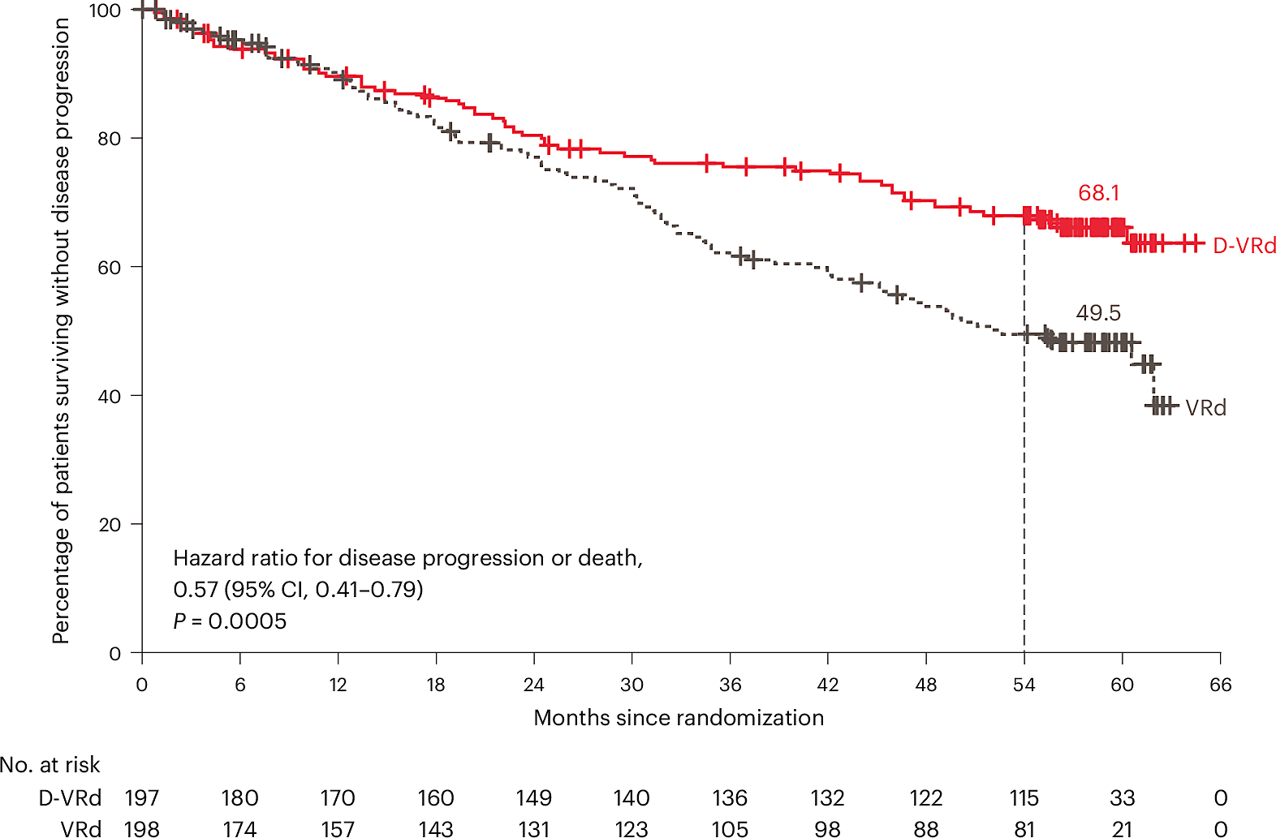
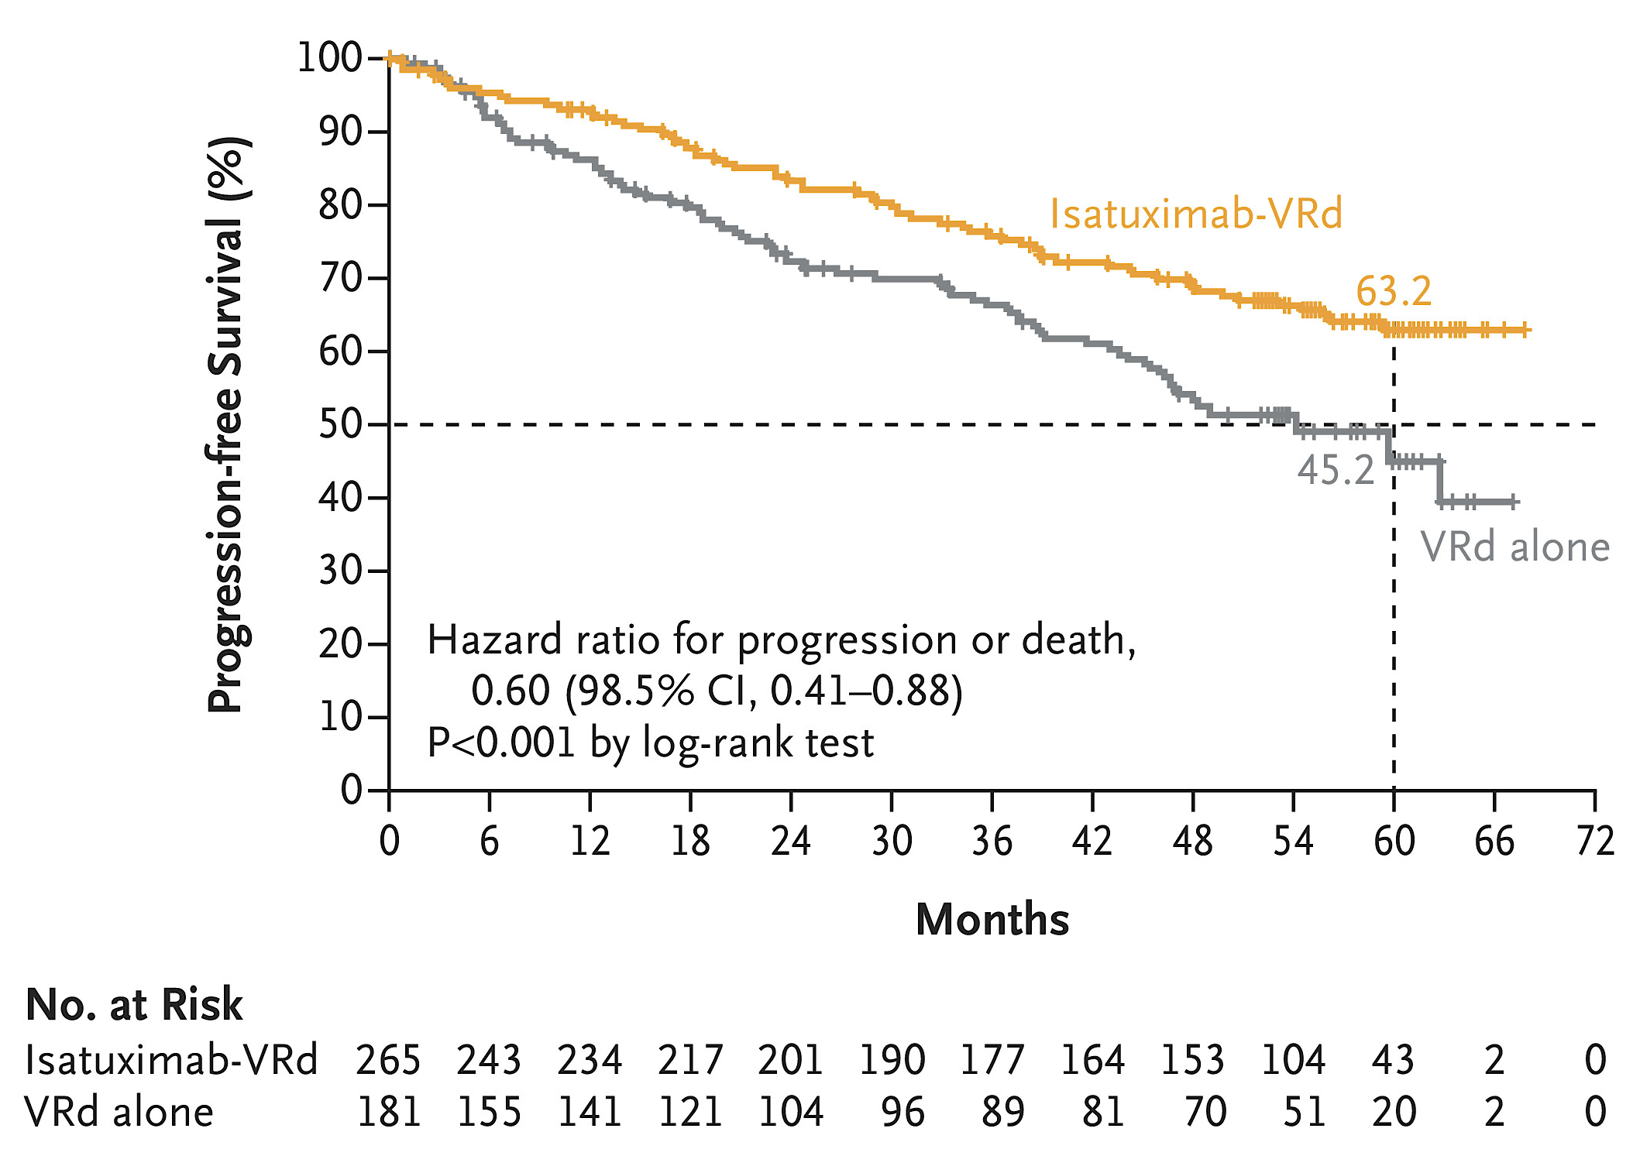
CD38 mAb / IMiD / PI Quadruplets in Newly-Diagnosed Myeloma: Transplant Deferred and Ineligible
Randomized phase III studies of VRd ± CD38 mAbs (CEPHEUS: Daratumumab; IMROZ: Isatuximab)
Key Eligibility Criteria
ECOG PS 0 – 2; Frailty index <2
Transplant ineligible: Age 70 – 80, <70 with comorbidities
Transplant deferred allowed
DVRd vs VRd
Median age: 70 (42 – 79) vs 70 (31 – 80)
≥70 y/o: 55.3% vs 55.6%
Transplant deferred: 26.9% vs 26.8%
Key Eligibility Criteria
ECOG PS 0 – 2, age ≤80
Transplant ineligible: Age ≥65 or comorbidities precluding ASCT
Isa-VRd vs VRd
Median age: 72 (60 – 80) vs 72 (55 – 80)
≥70 y/o: 69.4% vs 69.1%
CEPHEUS
IMROZ
Isa-VRd
DVRd
VRd
Progression-Free Survival
VRd
Progression-Free Survival
HR 0.60 (95% CI 0.41 – 0.88, P < 0.001)
HR 0.57 (95% CI 0.41 – 0.79, P = 0.0005)
Usmani S et al. Nature Med 2025;ePub ahead of print.
Facon T et al. New Engl J Med 2024;391:1597-1609
Courtesy of Peter Voorhees, MD

Slide 96
CD38 mAb / IMiD / PI Quadruplets in Transplant-Ineligible Patients with Newly-Diagnosed Myeloma: The BENEFIT of Bortezomib
Phase III study of Isa-Rd ± Bortezomib
Study Design: Isa-Rd x 12 cycles → Isa-R cycles 13+. For the Isa-VRd arm, bortezomib on days 1, 8 and 15 of cycles 1 – 12 and days 1 and 15 of cycles 13 – 18 added.
Key Eligibility Criteria: Deemed not transplant eligible, ages ≥65 – 79 years, frailty score <2, ECOG PS 0 – 2
Measurable Residual Disease
Progression-Free Survival
Leleu X et al. Nat Med 2024;30:2235-2241
Courtesy of Peter Voorhees, MD

Slide 97
CD38 mAb / IMiD / PI Quadruplets in Frail Patients with Newly-Diagnosed Myeloma: An IMROZ Subset Analysis
Key Eligibility Criteria: ECOG PS 0 – 2, transplant ineligible (age 65 – 79 or any age with comorbidities precluding safe transplant)
Modified IMWG Frailty Score: Based on age, modified Charlson Comorbidity Index, ECOG PS.
Frailty score 0 or 1: Non-frail; ≥2: Frail.
29% of patients were deemed frail (Isa-VRd 28%; VRd 32%)
Frail group enriched for patients with higher ECOG PS and ISS stage
Frail
Non-Frail
Isa-VRd
Isa-VRd
VRd
Progression-Free Survival
Progression-Free Survival
VRd
HR 0.584 (95% CI 0.340 – 1.004, P = 0.0516)
HR 0.593 (95% CI 0.403 – 0.873, P = 0.0080)
OS worse in frail vs non-frail patients
No difference in OS between Isa-VRD vs VRd arms for frail (HR 0.826, 95% CI 0.490 – 1.392, P = 0.4720) and non-frail (HR 0.734, 95% CI 0.453 – 1.188, P = 0.2076) patients
Manier S et al. IMS 2024.
Courtesy of Peter Voorhees, MD

Slide 98
CD38 mAb / IMiD / PI Quadruplets in Frail Patients with Newly-Diagnosed Myeloma: An IMROZ Subset Analysis
Median duration of treatment (Isa-VRd vs VRd)
Frail: 31.5 vs 23.7 mos
Non-Frail: 55.2 vs 36.6 mos
Median Relative Dose Intensity for Isa
Frail vs Non-Frail: 92.1% vs 94.0%
Median Relative Dose Intensity for Bortezomib
Frail: 90.3% vs 83.4%
Non-Frail: 90.0% vs 87.5%
Safety Metric | Frail |  | Non-Frail
 | Isa-VRd | VRd | Isa-VRd | VRd
D/C for any reason | 71.23% | 82.46% | 46.03% | 72.73%
D/C 2/2 Adverse Events | 30.14% | 35.09% | 20.11% | 24.79%
Any ≥Grade 3 TEAE (event rate per year) | 2.221 | 3.248 | 1.832 | 2.141
Any Grade 5 TEAE (event rate per year) | 0.975 | 1.979 | 0.509 | 0.416
Any TE SAE (event rate per year) | 1.051 | 1.340 | 0.989 | 1.296
QoL as measured by the EORTC-QLQ-C30
Frail
Non-Frail
Manier S et al. IMS 2024.
Courtesy of Peter Voorhees, MD

Slide 99
Conclusions
Quadruplets are a new standard of care for patients with newly diagnosed myeloma
Triplets remain an important standard of care: Age ≥80, frail patients defined more rigorously
The best PFS outcomes are those with quadruplets and upfront transplant
Impact of MRD-adapted consolidation on PFS and OS outcomes: TBD
Daratumumab + lenalidomide maintenance is a new standard of care for patients who are MRD+ after non-CD38 mAb-containing induction → ASCT
Optimal maintenance therapy for those treated with upfront quadruplets and transplant is unclear
GMMG-HD7, SWOG 1803
Courtesy of Peter Voorhees, MD

Slide 100
Selection of First-Line Therapy and Maintenance Treatment for Patients with Multiple Myeloma
Introduction: Myeloma Time Capsule
Module 1: Smoldering Myeloma
Module 2: Autologous Stem Cell Transplant (ASCT) Eligible
Module 3: ASCT Ineligible
Module 4: Subcutaneous Anti-CD38 Antibodies
Module 5: Special Considerations

Slide 101
Case Presentation – Prof Leleu: 53-year-old transplant-eligible patient with MM
Male, 53 years old, fit, working in a wine cellar.
Prior history of importance.
Severe trauma injury at 30 in the wine cellar. Long history of repeated surgery of both legs.
No regular medications.
The patient was admitted to nephrology department for acute renal insufficiency. Patient suffered from lower back pain for years that intensified months ago, patient thought it was related to history of trauma. Patient self-treated his back pain with anti-inflammatory drugs for months. The pain became acute a week ago and did not respond to AINS anymore, the patient went to his general practitioner to have “real pain killers”. CT of the back and basic lab tests were ordered.
Bio test.
Hb 9.5 g/dL, WBC and Plat normal values. Clearance creat at 20 mL/min, normally above 80 for the patient. Calcium was elevated above normal range. Protidemia 2 g/L. Serum protein electrophoresis showed hypogammaglobulinemia. SIF demonstrated kappa light chains. Urine was positive for proteinuria, 5g/24h 100% BJ. sFLC was kappa 30 000 mg/L, lambda 2 mg/L, ratio 15 000.
CT of the back confirmed multiple lytic lesions, and fracture of L4.
Patient was admitted immediately in Nephrology. The diagnosis of CAST nephropathy was made, and further checkup done in collaboration with the hematology department.

Slide 102
Case Presentation – Prof Leleu: 53-year-old transplant-eligible patient with MM (cont’d)
BM aspiration.
60% plasma cells, dystrophic nucleus.
Genomic (NGS). No del17p, no t(4;14), gain 1q pos, no t(11;14), no del1p32, no mutations of special interest.
ISS 3. RISS 2. Serum LDH level normal. No plasmablastic features. No CTC on CBC.
PET CT.
Multiple lytic lesions with hypermetabolisms, PMD from costal ribs right side K9 2x3 cm. No EMD.
Education on MM.
As a conclusion. NDMM SLiM CRAB on bone, PMD, sFLC ratio (ratio 110). Non HR, 53 fit TI. Acute RI but on AINS drugs. ECOG 2.
Immediately.
Hydration, correction of hypercalcemia, and DVd was started. Daratumumab, bortezomib and dexamethasone, special 40 mg x 4 days.
At end of cycle 1. Clearance creatinine had stabilized at 40 mL/min. sFLC dropped to K 5000, L2, ratio 2500.
Then Line 1.
Patient then started on D-VRd with objective to collect after 3 cycles, perform autologous transplantation after 6 cycles. V was given = twice weekly, R was given at 10 mg/day 21/28.

Slide 103
Case Presentation – Prof Leleu: 53-year-old transplant-eligible patient with MM (cont’d)
After cycle 2 patient developed neuropathy grade 1, grade 2 after injections decreasing to grade 1 after day 15. Patient experienced multiple episodes of diarrhea with difficulties to maintain clearance creatinine at 40 because of dehydration. Patient had severe local reactions on daratumumab.
D-VRd was maintained, but V was done on weekly basis at days 1/8/15.
After cycle 3. Apheresis was organized, but patient was not feeling good. Fatigue, neuropathy, diarrhea and local skin reaction grade 2. sFLC K 3000, L2, ratio 1500.
The medical team met with pharmacist, patient and family = decision was made to cancel apheresis, and to change the treatment to Isa-KRd for 1 cycle and see from there.
Isatuximab ss cut 1400 mg flat dose with OBI + K 20/56 mg/m² IV 30 minutes, R no change, dexa 20 mg on Isa or K days. Supportive care no change, lab monitoring no change.
At end of cycle 4. Clearance creatinine is stabilized at 40 mL/min. sFLC ratio is normalized. Local reactions have disappeared. Patient is feeling really great, fatigue grade 1 persists.
The patient had apheresis performed after cycle 4, it was successful for 2 grafts, as planned.
At end of cycle 6. Patient is back to ECOG 1.
sFLC ratio normalized. Clearance creatinine 45 mL/min. Neuropathy persists grade 1. No more local reactions.
The patient underwent ASCT, conditioned HDM 200 mg/m². One graft was reinjected, and the leftover was cryopreserved.

Slide 104
Case Presentation – Prof Leleu: 53-year-old transplant-eligible patient with MM (cont’d)
ASCT went smoothly enough.
After ASCT, the patient wished to resume work as it was August and the harvests were to be prepared… A post-transplant treatment was organized with Isa ss cut flat dose 1400 mg and K 56 on a monthly basis + R no dexa. This way, the patient was asked to come only once a month to the outpatient clinic. Tolerance was good, adhesion to treatment was good.
24 months later (3 years from diagnosis).
Clearance creatinine stabilized around 50 mL/min. sFLC ratio normalized. MRD test NGS was run upon patient request and was negative at 10⁻⁵ and 10⁻⁶.
The K was stopped and patient continued on Isa ss cut flat dose 1400 OBI until PD.
At 5 years from ASCT. Same conclusion.

Slide 105
According to current clinical trial data and your personal experience, in which clinical situations, if any, does a difference in efficacy exist between daratumumab and isatuximab?
None
20

Slide 106
Assuming subcutaneous formulations of isatuximab and daratumumab were both FDA approved and available and the efficacy and tolerability were equal, would you prefer one over the other for your patients with MM?
No preference
12
I would prefer Isa
4
I would prefer Dara
2
I prefer Dara but would consider Isa
1
Will consider Isa for 1q+ patients
1

Slide 107
Based on current clinical trial data and your personal experience, do you believe that patients will prefer the on-body delivery system for subcutaneous isatuximab to the administration method of subcutaneous daratumumab?
Yes
7
No
6
There are not enough available data at this time
7

Slide 108
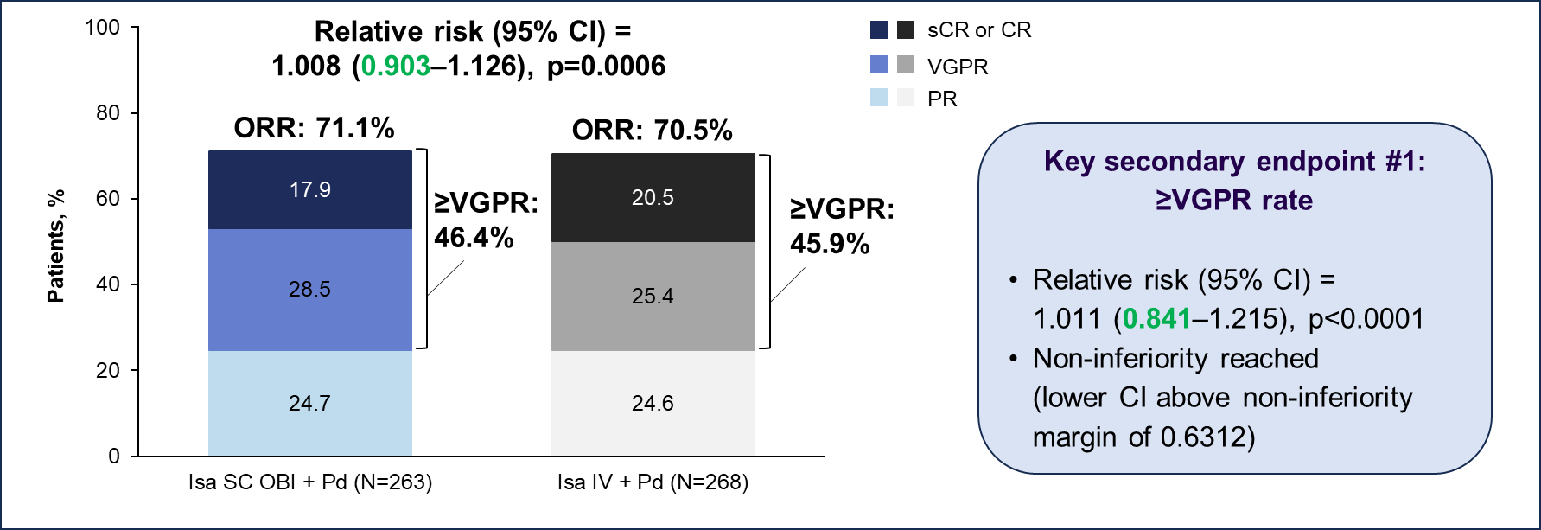
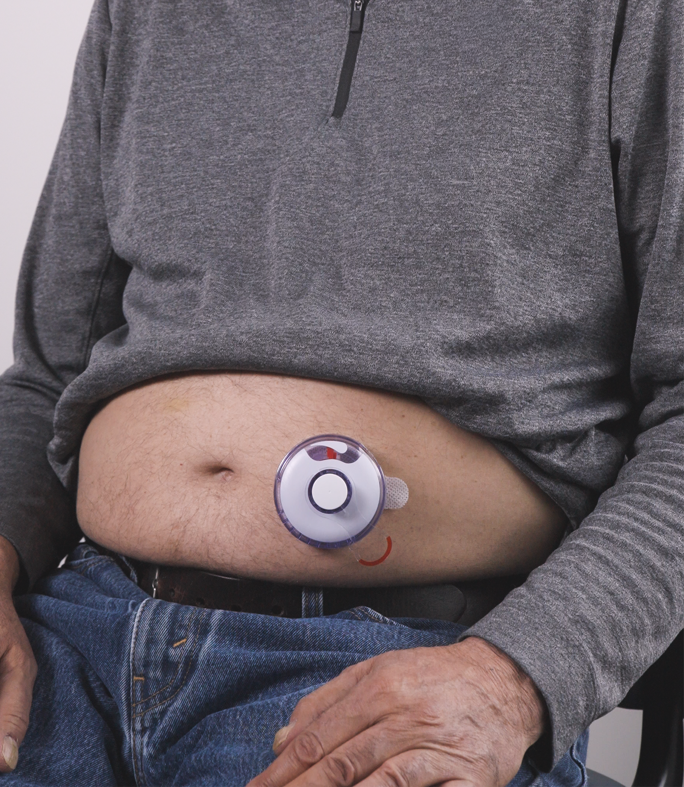
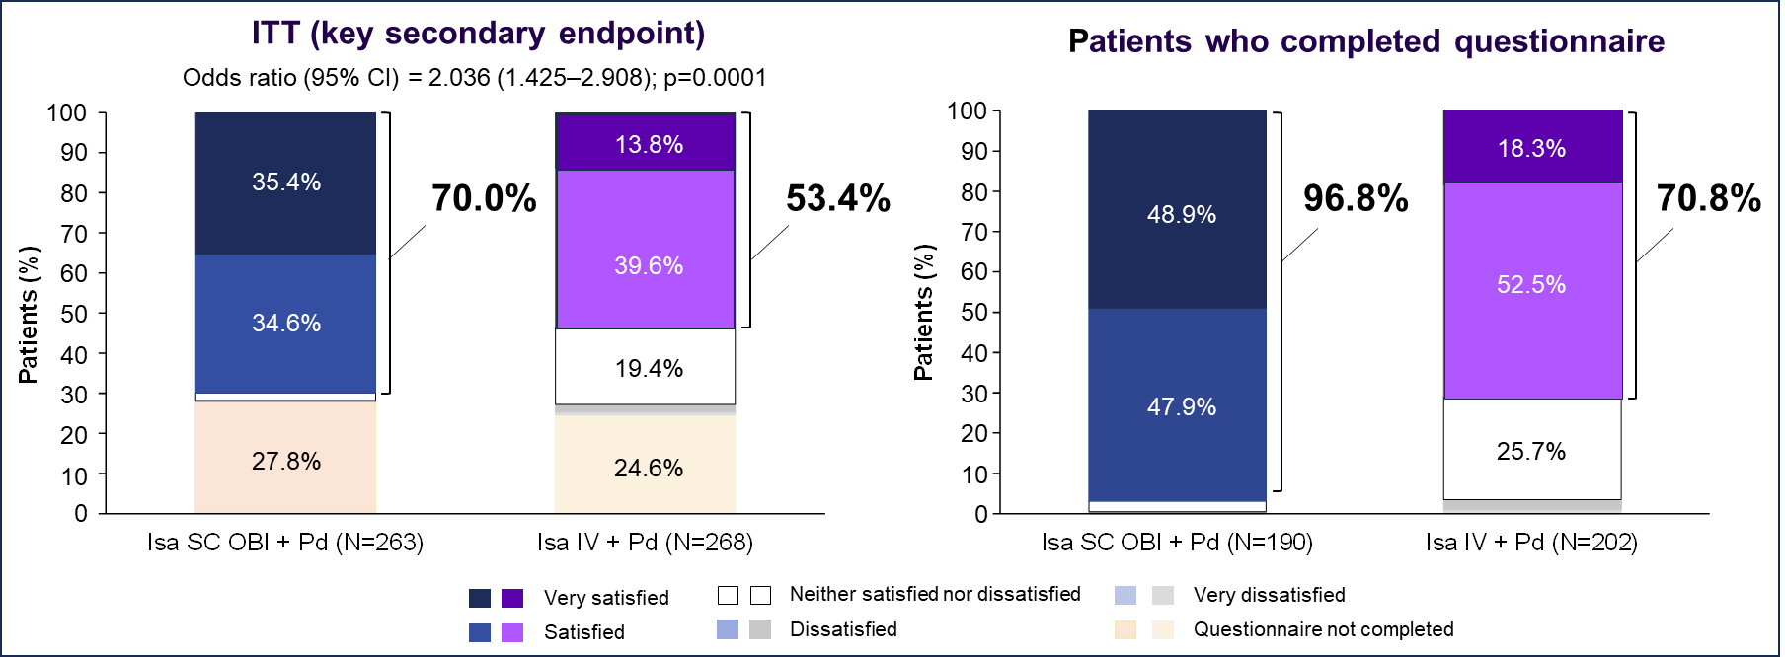
Subcutaneous Isatuximab for Relapsed Myeloma: IRAKLIA
Phase III study of IV Isa-Pd vs SC Isa-Pd for pts with RRMM and ≥1 prior line of therapy
IV Isa 10 mg/kg D1, 8, 15, and 22 with C1; D1, 15 with C2+
SC Isa 1400 mg flat dose using the same dosing schedule as IV
SC Isa delivered using an on-body delivery injector (OBI)
Infusion Reactions (SC vs IV): 1.5% vs 25%
≥Grade 3 neutropenia (SC vs IV): 84.7% vs 74.3%
Ailawadhi S et al. J Clin Oncol 2025; Leleu X et al EHA 2025.
Courtesy of Peter Voorhees, MD

Slide 109
Selection of First-Line Therapy and Maintenance Treatment for Patients with Multiple Myeloma
Introduction: Myeloma Time Capsule
Module 1: Smoldering Myeloma
Module 2: Autologous Stem Cell Transplant (ASCT) Eligible
Module 3: ASCT Ineligible
Module 4: Subcutaneous Anti-CD38 Antibodies
Module 5: Special Considerations

Slide 110
Regulatory and reimbursement issues aside, what is your preferred initial regimen for an 80-year-old patient with standard-risk MM who is transplant ineligible with new-onset renal failure not requiring dialysis?
Dara-Rd
3
Dara-CyBorD
7
Dara-RVd
3
Dara-Vd
3
Dara-Rd with reduced-dose R
3
Dara-RVd with adapted RV
1
How long would you continue induction treatment?
6 cycles
8
8 cycles
8
9 cycles
1
12 cycles
1
18 cycles
1
60 cycles
1

Slide 111
What maintenance therapy, if any, would you recommend, for an 80-year-old patient with standard-risk MM who was transplant ineligible with new-onset renal failure not requiring dialysis?
Dara-R
10
Dara alone
3
Dara-R or Dara alone
2
Dara-V
1
Dara-Rd
1
Dara-Rd and drop d after 9 cycles
1
Dara +/- V
1
R alone
1
How long would you continue maintenance therapy?
2 years
2
3 years
3
Indefinitely
14
Depends on likelihood of renal recovery
1

Slide 112
Regulatory and reimbursement issues aside, what is your preferred initial regimen for an 80-year-old patient with high-risk (eg, del[17p]) MM who is transplant ineligible with new-onset renal failure not requiring dialysis?
Dara-CyBorD
7
Dara-Vd
3
Dara-Rd
4
Dara-RVd
3
Dara-RVd with adapted RV
1
Dara-Rd with reduced-dose R
1
Dara-CyBorD modified
1
How long would you continue induction treatment?
6 cycles
5
8 cycles
7
9 cycles
1
12 cycles
4
18 cycles
1
24 cycles
1
60 cycles
1

Slide 113
What maintenance therapy, if any, would you recommend for an 80-year-old patient with high-risk (eg, del[17p]) MM who was transplant ineligible with new-onset renal failure not requiring dialysis?
Dara-R
11
Dara-V
3
Dara alone
1
Dara-Rd
1
Dara-Rd with reduced-dose R then Dara alone
1
Dara-Rd and drop d after 9 cycles
1
Dara-V +/- R
1
RV
1
How long would you continue maintenance therapy?
2 years
1
3 years
2
Indefinitely
17

Slide 114
Regulatory and reimbursement issues aside, what is your preferred initial regimen for an 80-year-old patient with standard-risk MM who is transplant ineligible with a history of Type 2 diabetes with preexisiting peripheral neuropathy?
Dara-Rd
15
Dara-R
2
Dara-Rd with reduced-dose d
1
Dara-RVd lite
1
Dara-R +/- d
1
How long would you continue induction treatment?
2 cycles
2
6 cycles
4
8 cycles
5
9 cycles
3
12 cycles
3
18 cycles
1
24 cycles
1
60 cycles
1

Slide 115
What maintenance therapy, if any, would you recommend for an 80-year-old patient with standard-risk MM who was transplant ineligible with a history of Type 2 diabetes with preexisiting peripheral neuropathy?
Dara-R
14
Dara alone
2
Dara-R or Dara alone
1
Dara-R then Dara or R alone
1
Dara-Rd and drop d after 9 cycles
1
R alone
1
How long would you continue maintenance therapy?
2 years
2
3 years
3
Indefinitely
15

Slide 116
Regulatory and reimbursement issues aside, what is your preferred initial regimen for an 80-year-old patient with high-risk (eg, del[17p]) MM who is transplant ineligible with a history of Type 2 diabetes with preexisiting peripheral neuropathy?
Dara-Rd
11
Dara-Rd with reduced-dose d
1
Dara-Rd or Dara-KRd
1
Dara-KRd
1
Dara-RVd lite
1
Dara-R
1
Dara-R +/- K
1
Dara-IRd
1
Isa-KRd with reduced-dose K
1
RVd with monthly V
1
How long would you continue induction treatment?
2 cycles
2
6 cycles
5
8 cycles
6
9 cycles
2
12 cycles
3
18 cycles
1
60 cycles
1

Slide 117
What maintenance therapy, if any, would you recommend for an 80-year-old patient with high-risk (eg, del[17p]) MM who was transplant ineligible with a history of Type 2 diabetes with preexisiting peripheral neuropathy?
Dara-R
12
Dara alone
2
Dara-IRd then Dara alone
1
Dara-R then Dara or R alone
1
Dara-Rd and drop d after 9 cycles
1
Dara or R alone
1
R alone
1
Kd
1
How long would you continue induction treatment?
3 years
1
Indefinitely
19

Slide 118
Practical Perspectives: Experts Review Actual Cases of Patients with Small Cell Lung Cancer
A CME/MOC-Accredited Live Webinar
Wednesday, July 16, 2025 5:00 PM – 6:00 PM ET
Faculty
Stephen V Liu, MD
Charles Rudin, MD, PhD
Moderator
Neil Love, MD

Slide 119
Thank you for joining us! Please take a moment to complete the survey currently up on Zoom. Your feedback is very important to us. The survey will remain open for 5 minutes after the meeting ends. Information on how to obtain CME and ABIM MOC credit is provided in the Zoom chat room. Attendees will also receive an email in 1 to 3 business days with these instructions.

