Slide 1
Data + Perspectives: Clinical Investigators Explore the Application of Recent Datasets in Current Oncology Care
CME/MOC, NCPD and ACPE Accredited
Saturday, October 11, 2025
7:15 AM – 12:30 PM ET

Slide 2
Agenda
Module 1 — Breast Cancer: Drs Burstein, Goetz, McArthur and Nanda
Module 2 — Prostate Cancer: Drs Antonarakis and M Smith
Module 3 — Colorectal Cancer: Drs Lieu and Strickler
Module 4 — Diffuse Large B-Cell Lymphoma and Follicular Lymphoma: Drs Lunning and S Smith

Slide 3


Diffuse Large B-Cell Lymphoma and Follicular Lymphoma Faculty
Matthew Lunning, DO
Professor
Medical Director
Gene and Cellular Therapy
Associate Vice Chair of Research
Department of Medicine
Assistant Vice Chancellor for Clinical Research
Fred and Pamela Buffett Cancer Center
University of Nebraska Medical Center
Omaha, Nebraska
Sonali M Smith, MD
Elwood V Jensen Professor of Medicine
Chief, Section of Hematology/Oncology
Co-Leader, Cancer Service Line
The University of Chicago
Chicago, Illinois

Slide 4
Which Driver & Which Race:
CAR-T & BsAb for Relapsed or Refractory DLBCL & Follicular Lymphoma
Matthew Lunning, DO, FACP
Professor, Division of Oncology & Hematology
Medical Director, Gene & Cellular Therapy
Assistant Vice Chancellor for Clinical Research

Slide 5
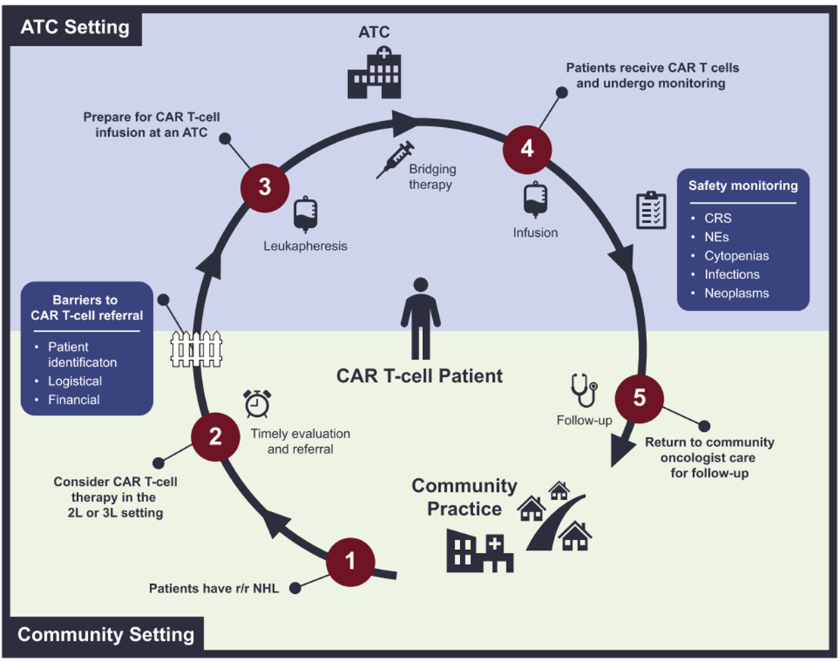
It Takes a Pit Crew
Bishop MR, Kay GE. Semin Oncol. 2024

Slide 6
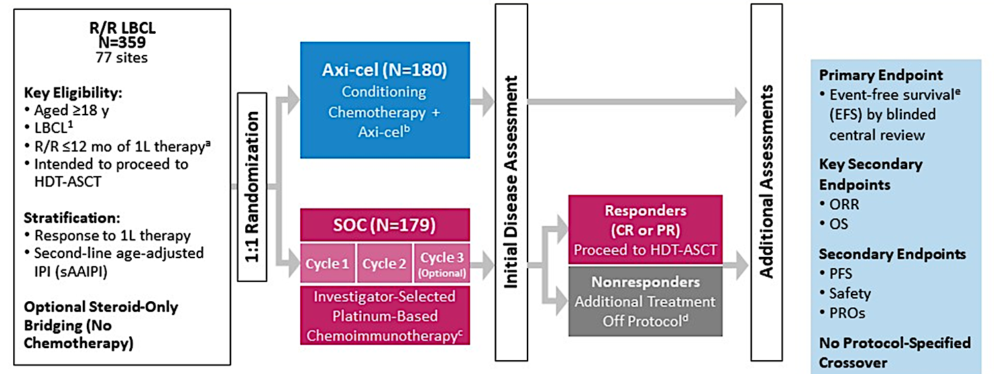
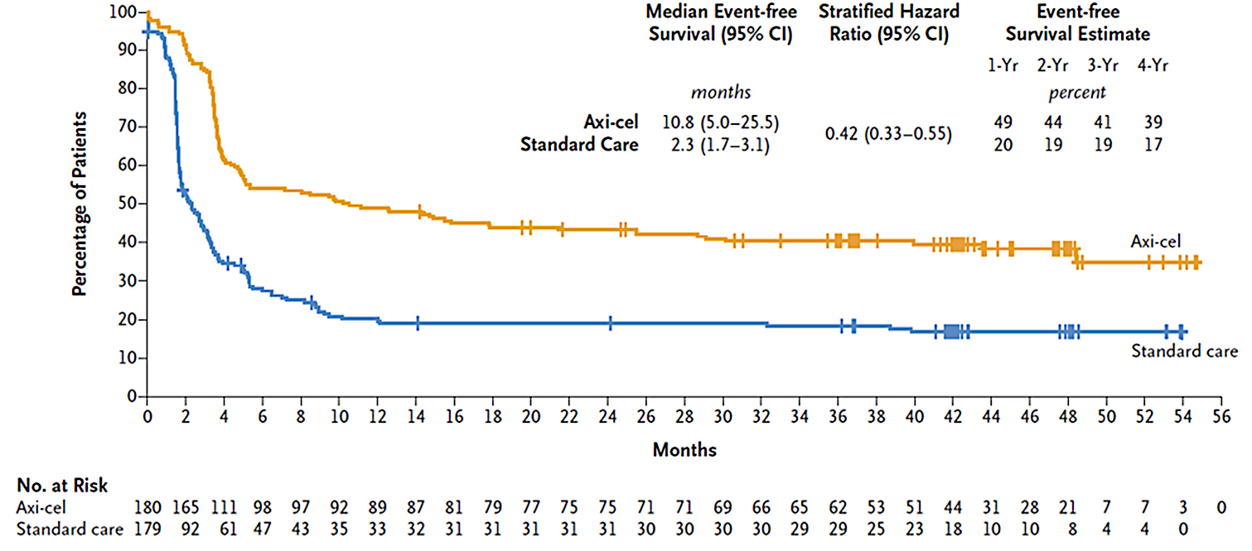
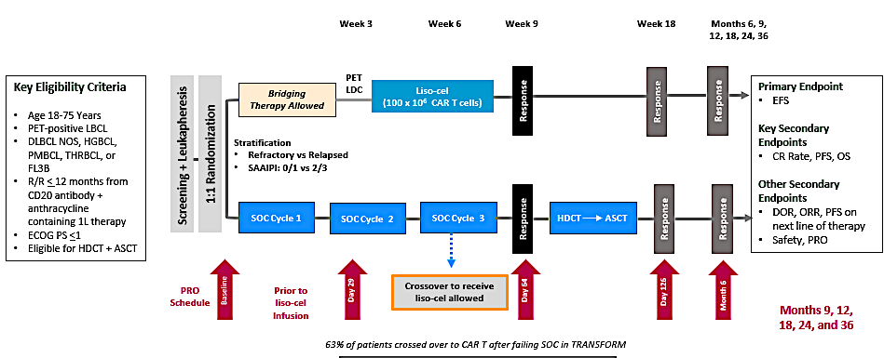
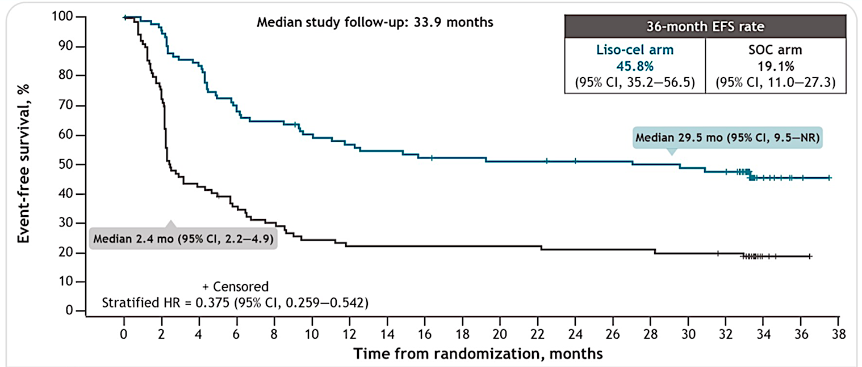
Sprint Cars: ZUMA-7/TRANSFORM
ZUMA-7
4-Year Follow-Up
TRANSFORM
3-Year Follow-Up
Locke et al. NEJM 2022; Westin et al. New Engl J Med 2023; Abramson et al. Blood 2023; Kamdar et al. J Clin Oncol 2025

Slide 7
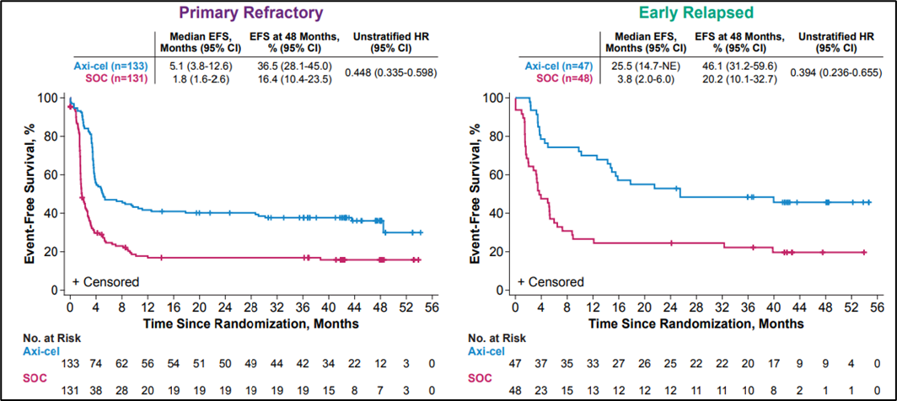
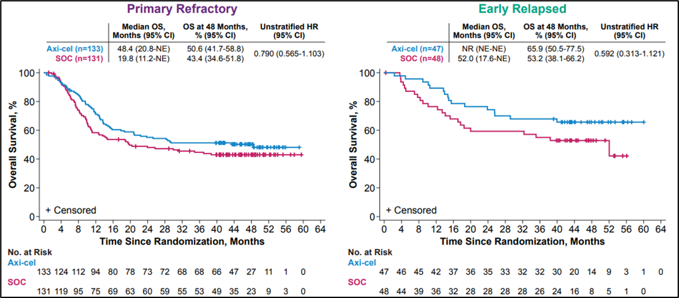
Use Your Spotter?
ZUMA-7
Westin JR et al. ASTCT 2025;Abstract 283

Slide 8
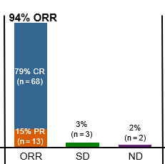
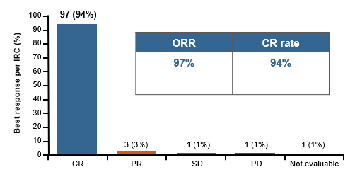
LeMonds: CAR-T for 3L FL
Axi-cel
Tisa-cel
Liso-cel
Efficacy Cohort | %
ORR | 86
CRR | 68
Jacobson, et al. Lancet Oncol 2022; Schuster ASH 2023;Abstract 601; Neelapu et al. ASH 2024;Abstract 864

Slide 9
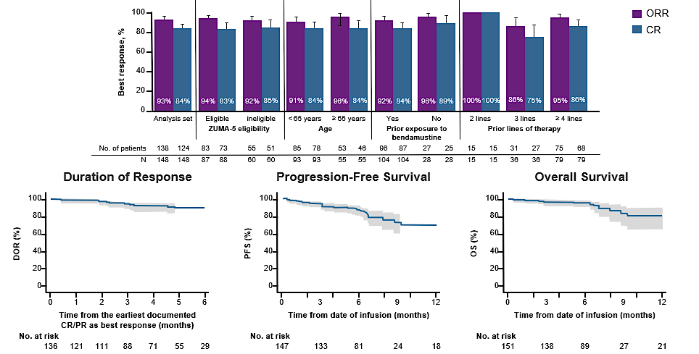
LeMonds: CAR-T for 3L FL
Jacobson CA et al. ASCO 2023;Abstract 7509

Slide 10
Going Two Wide:
Epco & Glofit for Rel/Ref LBCL
 | Epcoritamab (N=157) | Glofitamab (N=155)
Population | 2+ prior therapies (allowed p CAR-T) | 2+ prior therapies (allowed p CAR-T)
Median F/U | 37.1 months | 41.0 months
ORR | 59% | 52%
CR | 41% | 40%
PFS of CR | 37.3 months | 57%
OS of CR | NR | 77%
CRS | All Grades: 51% G1: 32% G2: 16% G3/4 : 3% | All Grades: 63% G1: 43% G2: 16% G3/4: 4%
Vose et al. ASH 2024;Abstract 4480; Dickinson et al. ASH 2024;Abstract 865; Dickinson et al. NEJM 2022

Slide 11
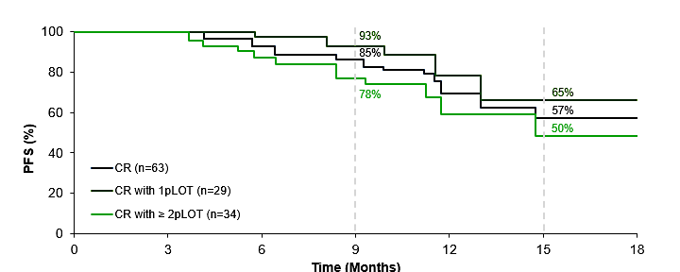
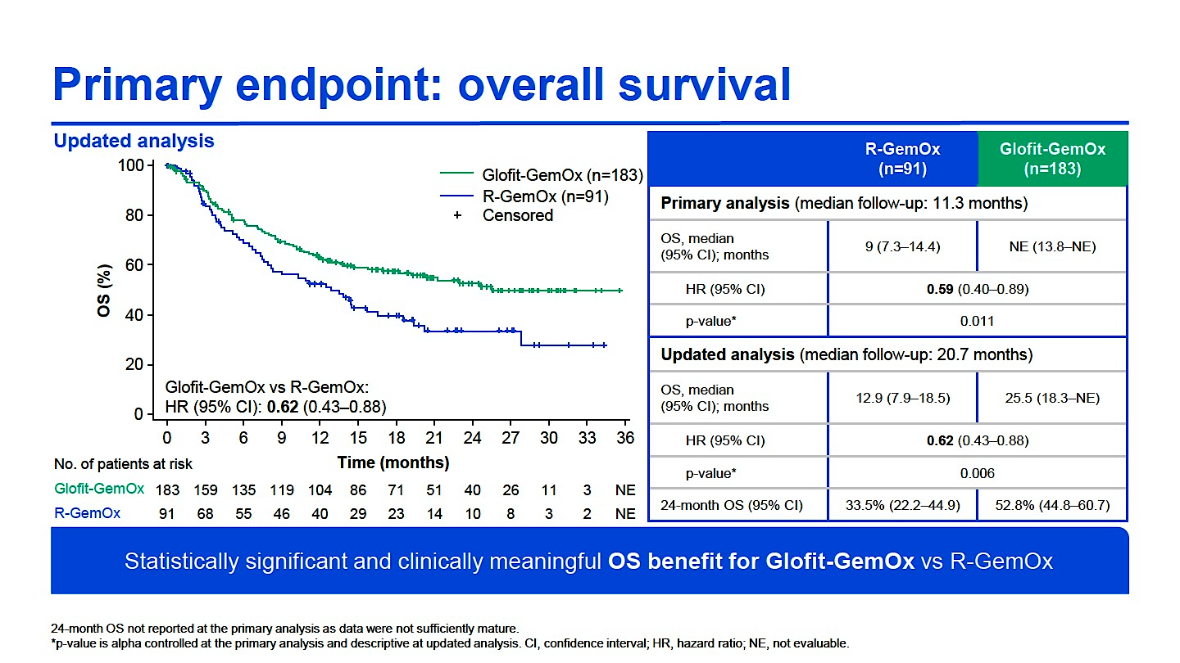
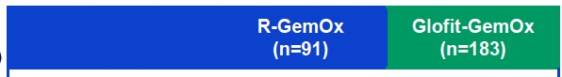
Who’s Driving the Benefit?
Epco + Gem-Ox
Glofit + Gem-Ox
Brody J, et al. ASCO 2024;Abstract 7037; Abramson J, et al. EHA 2024;Abstract LB3438

Slide 12
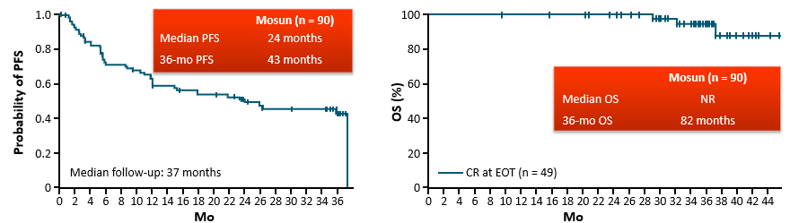
Mosun in Rel/Ref FL
%
%
Sehn et al. Blood 2025

Slide 13
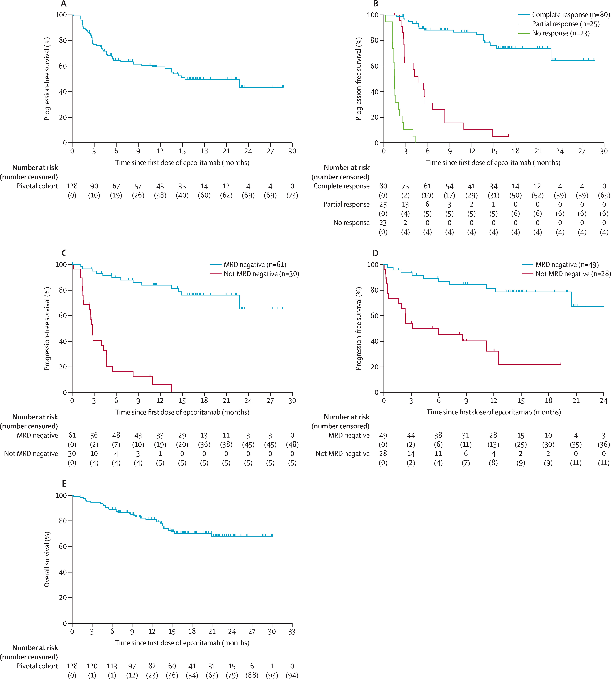
Epco in Rel/Ref FL
CRR | 63%
18-month PFS | 49%
Linton KM et al. Lancet Haematol 2024

Slide 14
Phase 3 EPCORE FL-1 Clinical Trial Met Dual Primary Endpoints in Patients with Relapsed/Refractory (R/R) Follicular Lymphoma (FL)
Press Release: August 7, 2025
“[The manufacturer] today announced positive results of the Phase 3 EPCORE FL-1 trial evaluating subcutaneous epcoritamab, a bispecific antibody, in combination with rituximab and lenalidomide (R²) versus R² alone for the treatment of adult patients with relapsed or refractory (R/R) follicular lymphoma (FL).
The study met its dual primary endpoints of overall response rate (ORR, p-value < 0.0001) and progression-free survival (PFS, HR 0.21, p-value <0.0001), demonstrating statistically significant and clinically meaningful differences in both endpoints, reducing the risk of disease progression or death by 79%.
The results, derived from a pre-planned interim analysis, will be submitted for presentation at the 67th Annual Meeting and Exposition of the American Society of Hematology (ASH) and will serve as the basis for global regulatory submissions.”
https://ir.genmab.com/news-releases/news-release-details/genmab-announces-phase-3-epcorer-fl-1-clinical-trial-met-dual

Slide 15
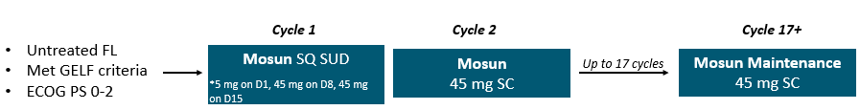
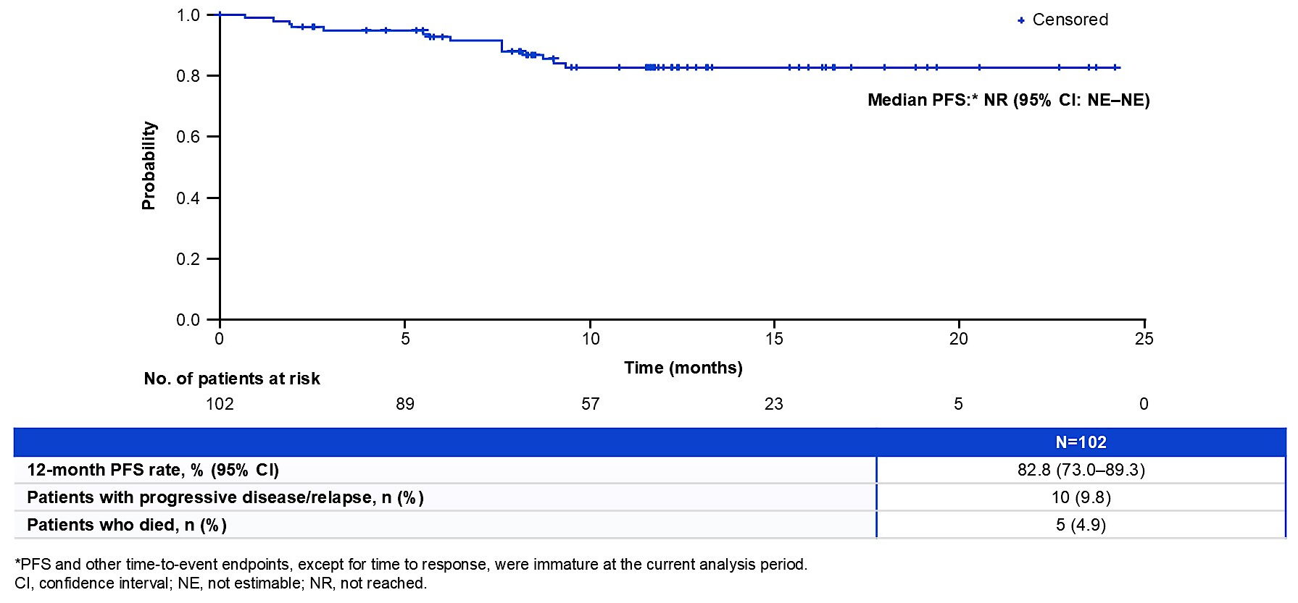
BsAb in Front Line FL
Flinn et al. ASCO 2025;Abstract 7014

Slide 16

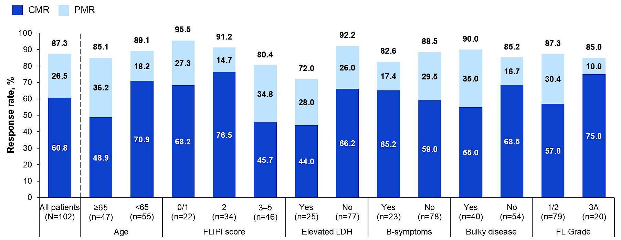
BsAb in Front Line FL
Flinn et al. ASCO 2025;Abstract 7014

Slide 17
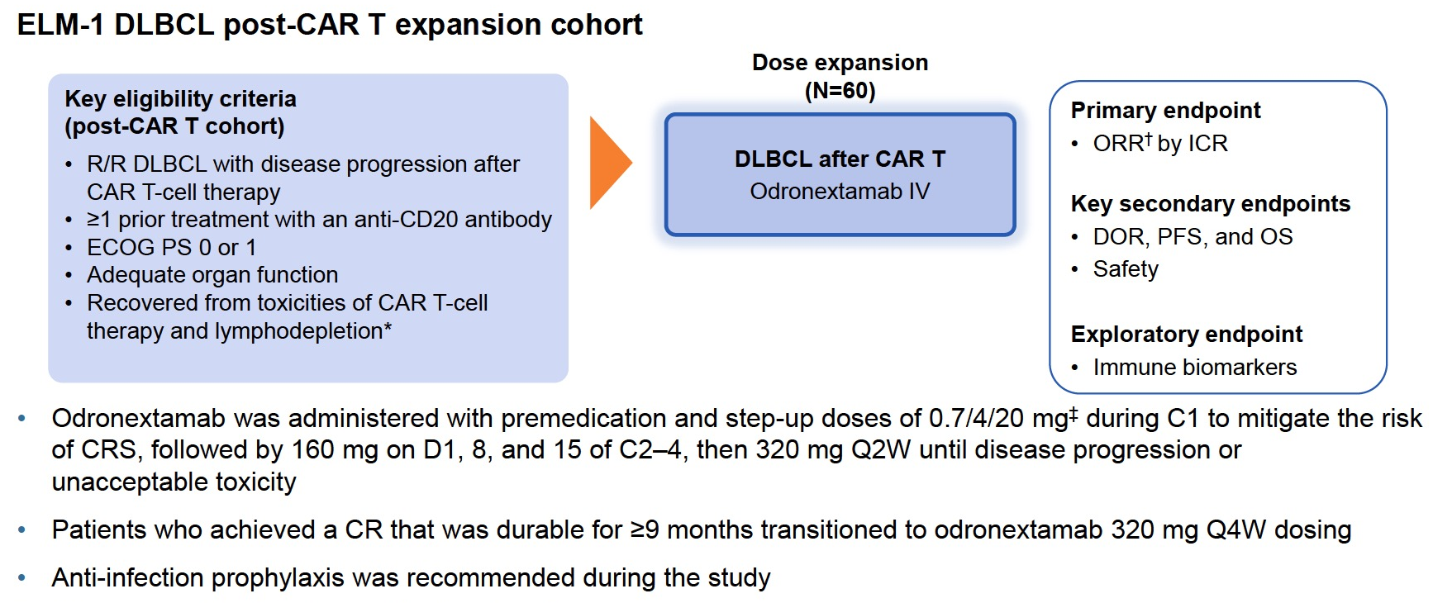
Odronextamab: Side CAR-T
Matasar et al. ASH 2024;Abstract 866

Slide 18
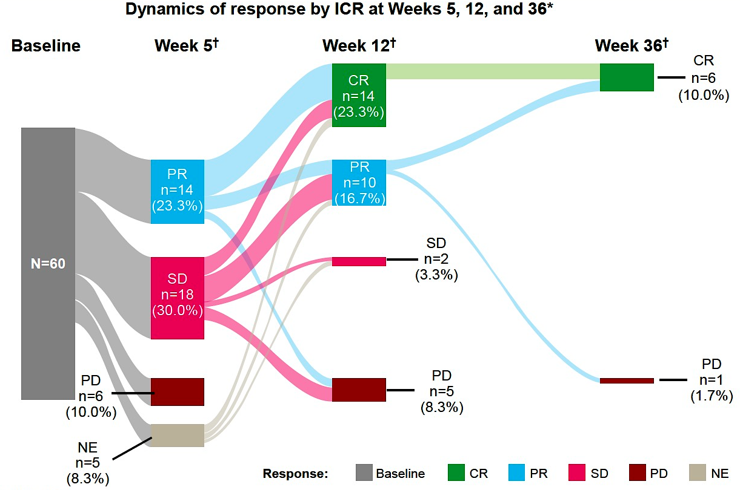
ELM-1 (Odronextamab) post CAR-T
Matasar et al. ASH 2024;Abstract 866

Slide 19
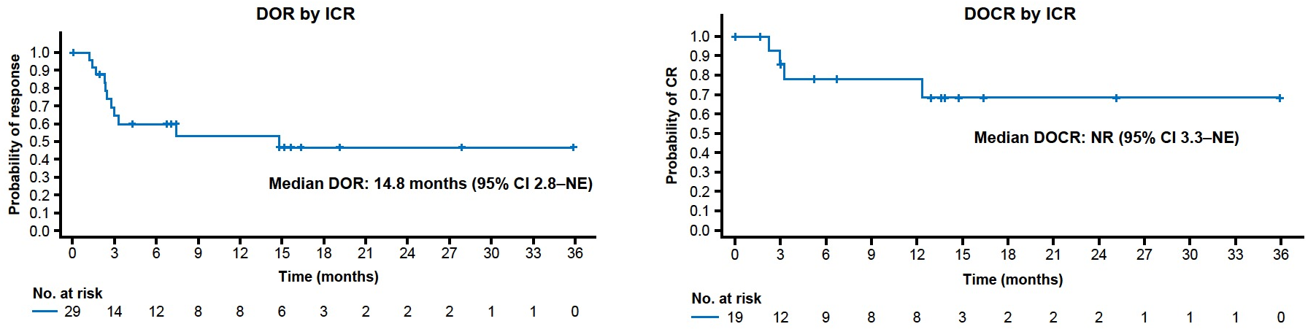
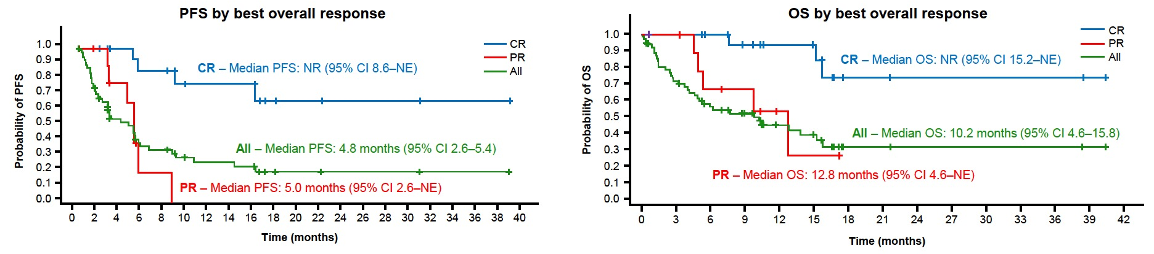
ELM-1 (Odronextamab) post CAR-T
Matasar et al. ASH 2024;Abstract 866

Slide 20
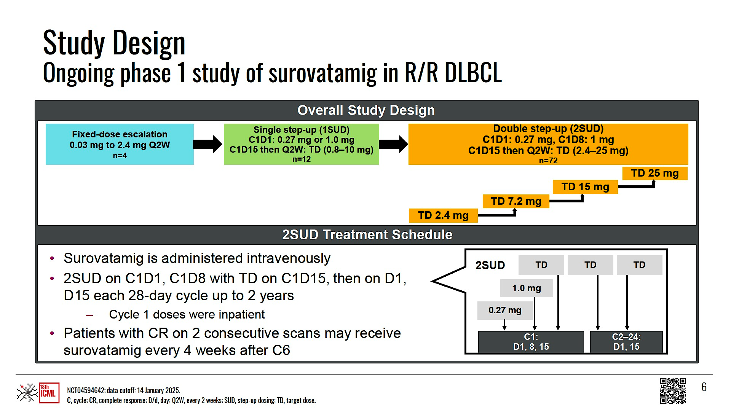
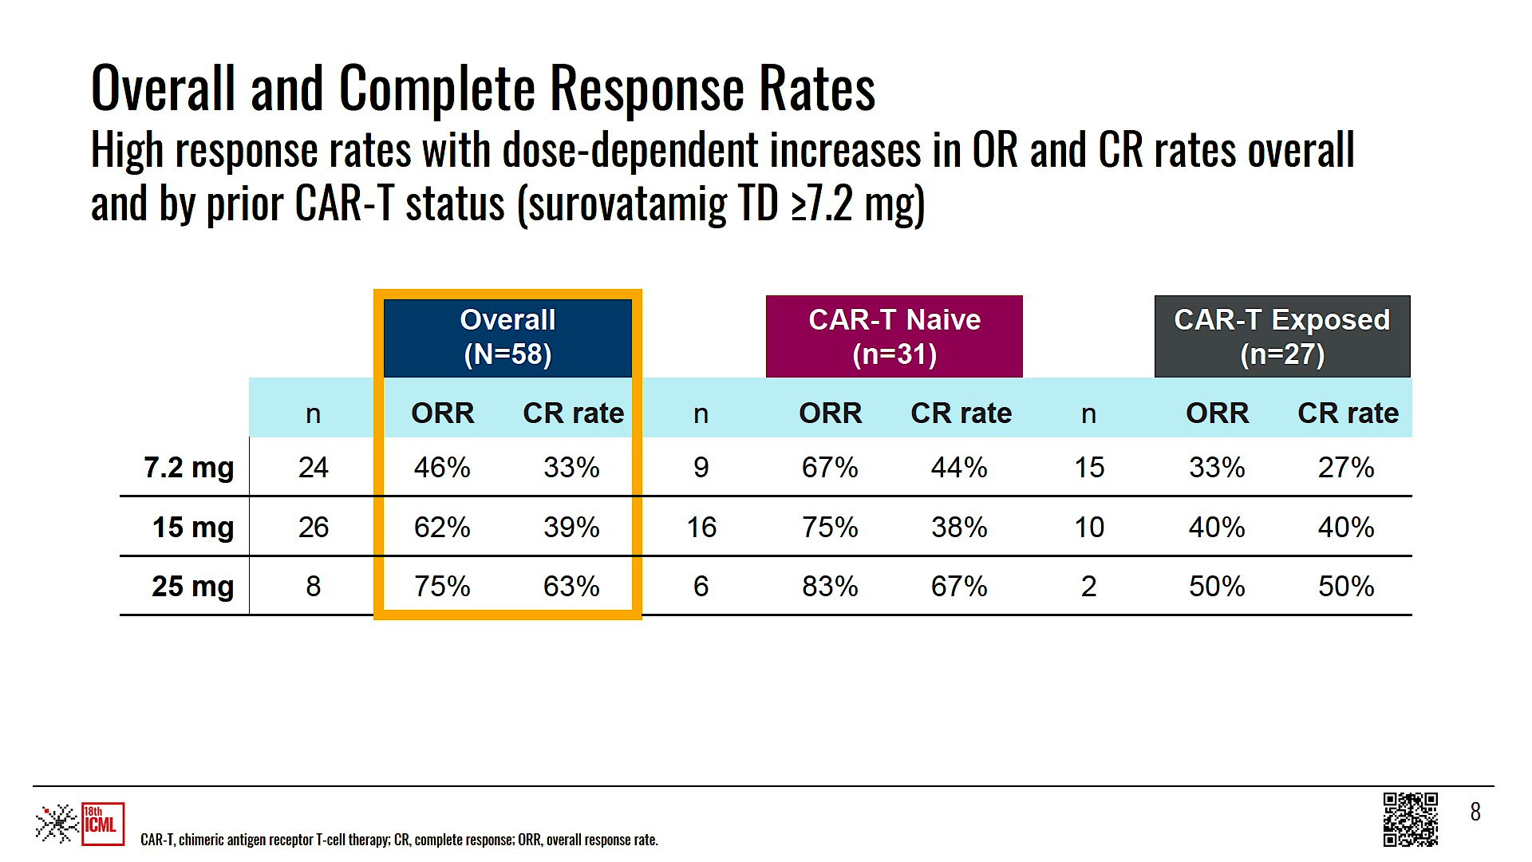
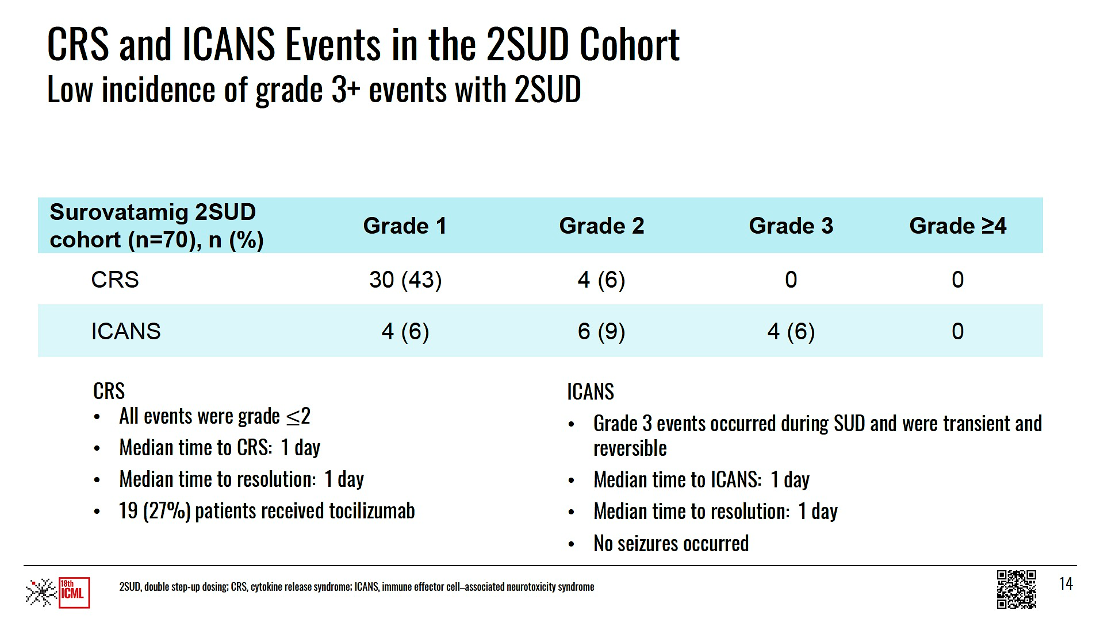
Super Charger: Surovatamig (AZD0486) [CD3 X CD19]
Hun-Yoon et al. EHA 2025;Abstract PS1927

Slide 21
SOUNDTRACK-F1: Phase III Study of Surovatamig (AZD0486) Plus Rituximab in Previously Untreated FL
Surovatamig + rituximab
(schedule A)
R
(N = 1015)
Previously untreated FL
Surovatamig + rituximab
(schedule B)
Investigator's choice of chemoimmunotherapy
(R-CHOP, R-CVP, or BR)
ClinicalTrials Identifier: NCT06549595. Accessed October 2025.

Slide 22
Data + Perspectives: Clinical Investigators Explore the Application of Recent Datasets in Current Oncology Care
CME/MOC, NCPD and ACPE Accredited
Saturday, October 11, 2025
7:15 AM – 12:30 PM ET

Slide 23
Questions from General Medical Oncologists
In general, how do you decide between the three available CAR T-cell products, and does it matter if the patient has DLBCL or FL?

Slide 24
Questions from General Medical Oncologists
How do you usually sequence CAR T-cell therapy and bispecific antibodies in DLBCL? What about in FL?
Is there any available data for combining CAR T-cell therapy with a bispecific antibody?

Slide 25
Questions from General Medical Oncologists
CASE: For a 44-year-old woman with multiply relapsed FL who is otherwise fit, at what point would you recommend CAR-T?
CASE: A 76-year-old man with DLBCL relapses within 6 months of R-CHOP but is not a candidate for transplant. Which would you recommend: CAR T,
Pola-R-GemOx or a bispecific antibody?

Slide 26
Questions from General Medical Oncologists
What is the spectrum of CRS symptoms seen with CAR-T, and how are they managed?
How would you compare the frequency and severity of CRS associated CAR T versus bispecific antibodies?
Is there a role for prophylactic tocilizumab in patients receiving CAR T-cell therapy? What about for patients getting a bispecific antibody?

Slide 27
Questions from General Medical Oncologists
How long after CAR T-cell therapy administration does ICANS normally present? Does ICANS occur with bispecific antibodies?

Slide 28
Questions from General Medical Oncologists
How do you prevent and manage infections in patients who are receiving bispecific antibodies? How do you approach vaccinations for these patients? What about patients who have undergone CAR T-cell therapy?

Slide 29
Available and Emerging Novel Therapies for Diffuse Large B-Cell Lymphoma (DLBCL) and Follicular Lymphoma (FL)
Sonali Smith, MD FASCO
Elwood V. Jensen Professor of Medicine
Chief, Section of Hematology/Oncology
Co-Leader, Cancer Service Line
Notes:
30 min
Includes 2 MOC questions

Slide 30
Overview
TN DLBCL
RR DLBCL
RR FL
Pola-RCHP updates
RCHOP-acala (ESCALADE)
POLARGLO
Tafasitamab + lenalidomide
Loncastuximab-tesirine
Tafasitamab + lenalidomide + rituximab (InMIND)
Zanubrutinib + obinutuzumb (ROSEWOOD)
Loncastuximab-tesirine combos
Golcadomide

Slide 31
Frontline DLBCL

Slide 32
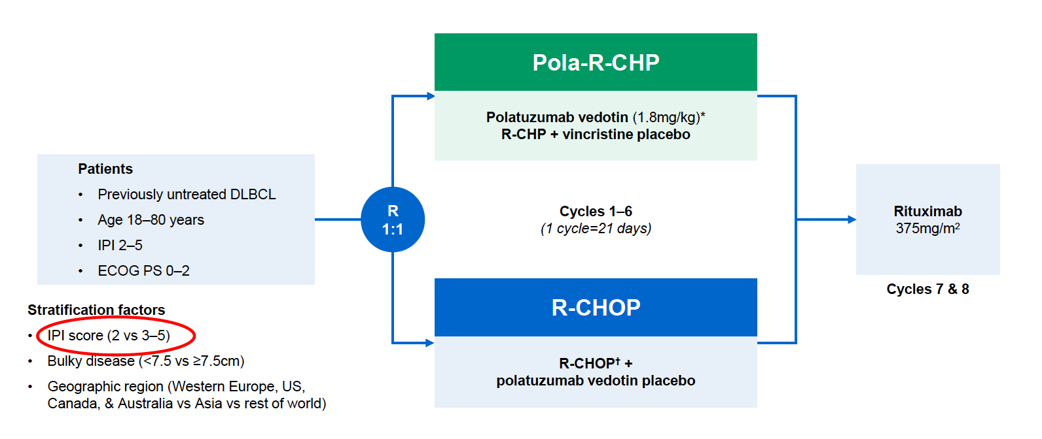
POLARIX: randomized, double-blind, placebo-controlled phase 3 international trial of Pola-R-CHP vs. R-CHOP in high-risk TN DLBCL
6.5% improvement in 24m PFS (HR 0.73)
COO was not a stratification factor
PRIMARY ENDPT: PFS
Med f/u 28.2m
Tilly N Engl J Med. 2022 Jan 27;386(4):351-363
Notes:
POLARIX did not formally test for an interaction based on COO

Slide 33
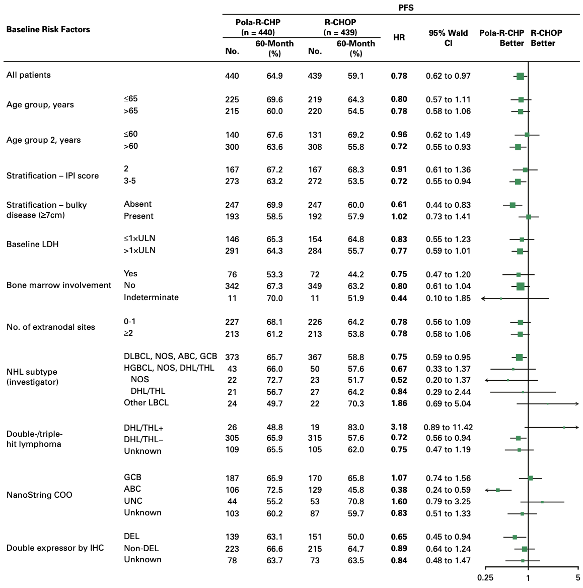
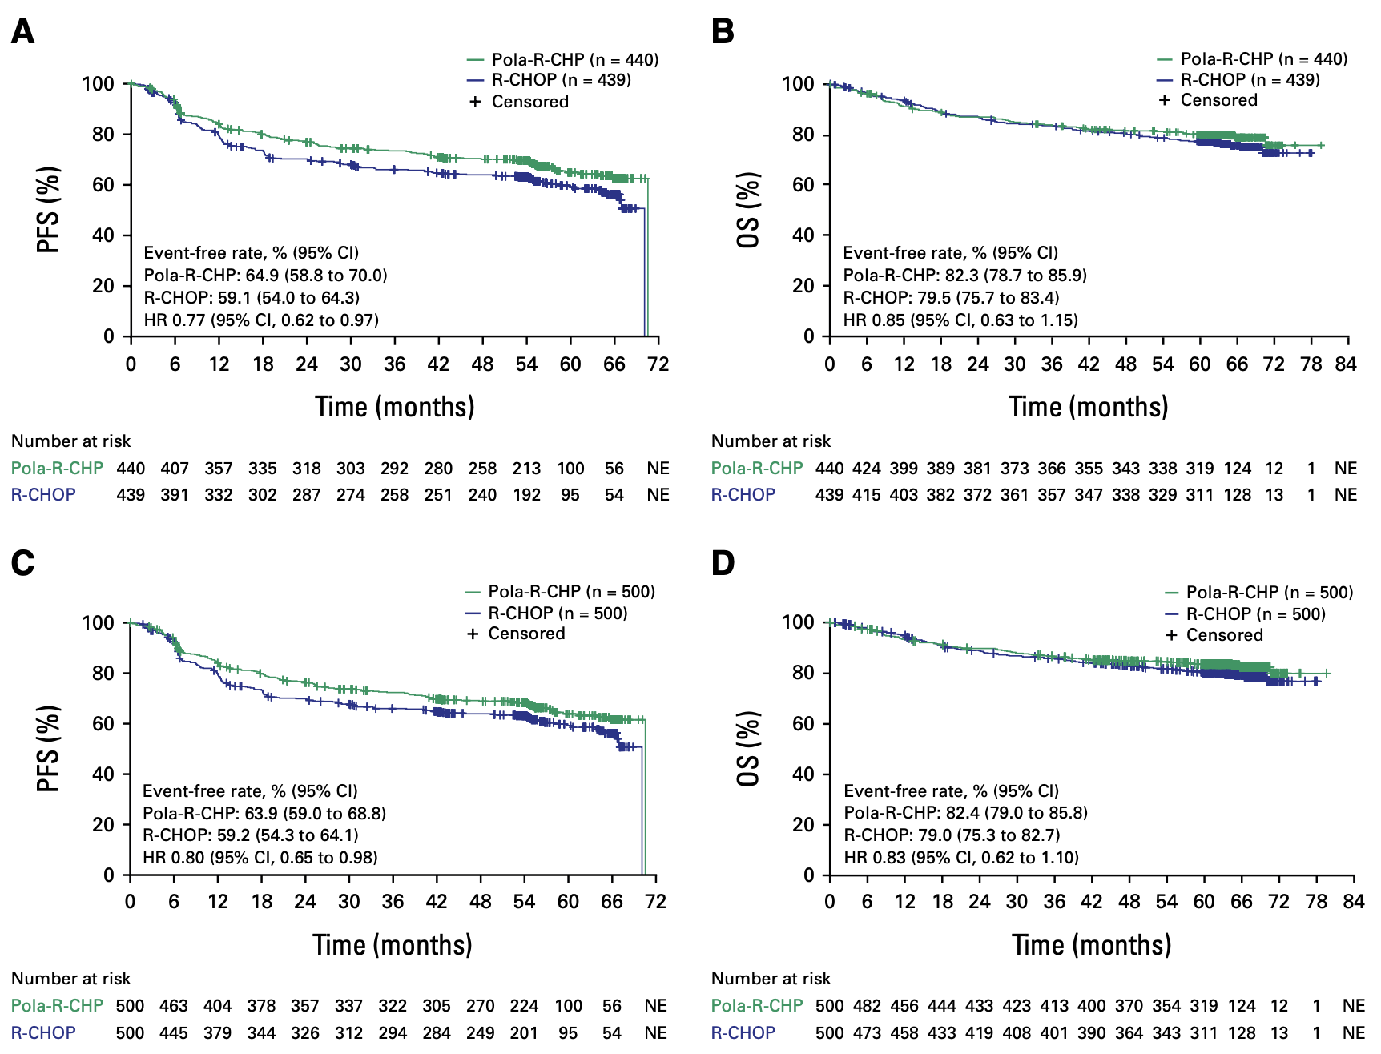
POLARIX: what’s new?
5y update: persistent PFS advantage for pola-R-CHP; no OS advantage
Morschhauser F J Clin Oncol 2025; Sep25 [online ahead of print].

Slide 34
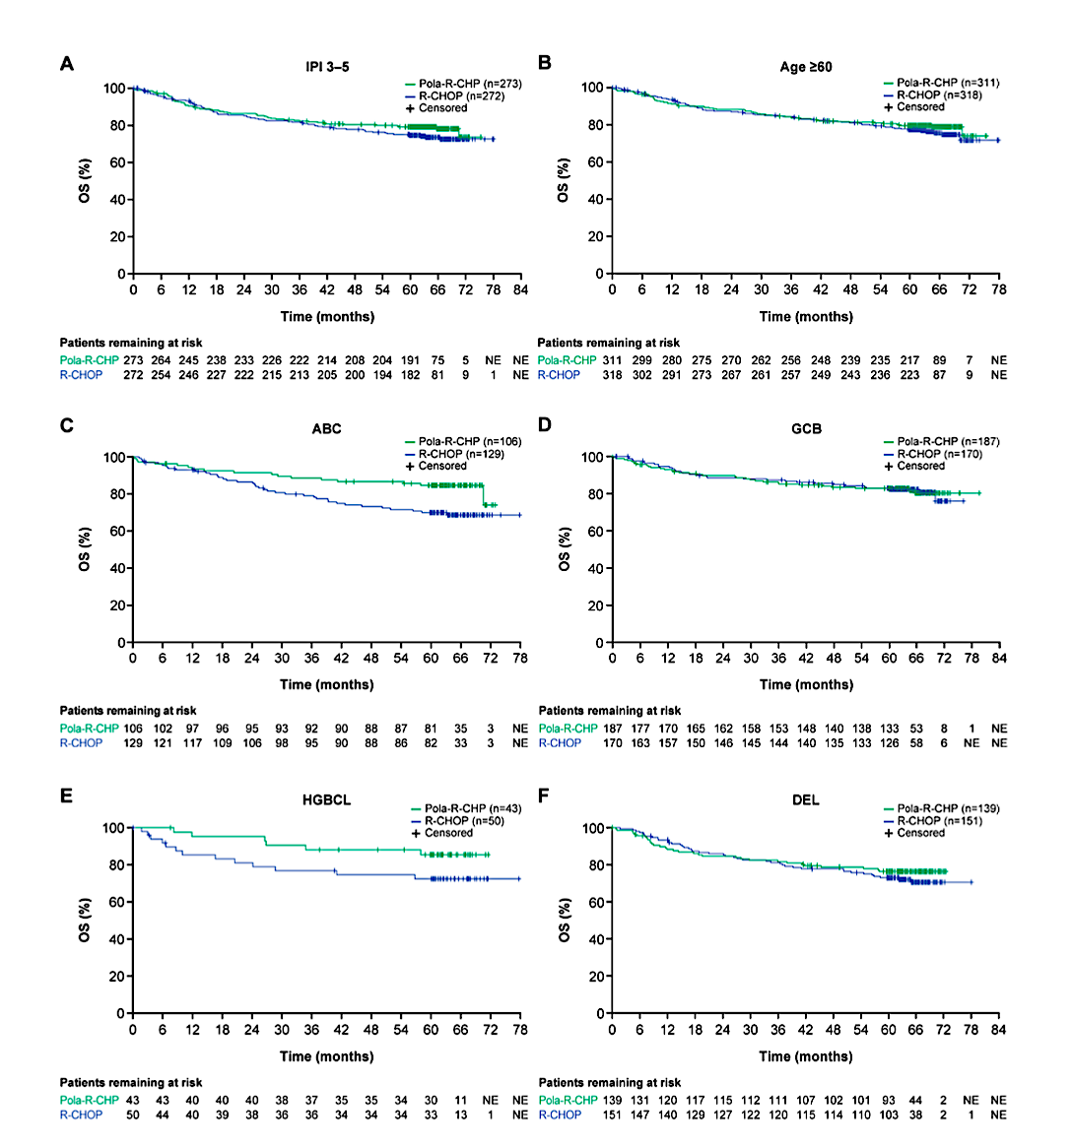
POLARIX: what’s new? OVERALL SURVIVAL in specific subgroups
Favorable OS advantage in ABC (NanoString) and HGBCL groups
Morschhauser F J Clin Oncol 2025; Sep25 [online ahead of print].

Slide 35
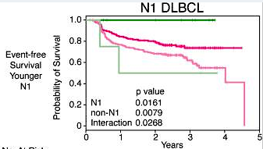
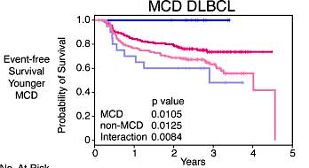
From PHOENIX (R-CHOP +/- ibrutinib) to ESCALADE (R-CHOP +/- acalabrutinib) for non-GC DLBCL
PHOENIX was a negative trial
Increased toxicity in older patients
Gap from dx to treatment
Underlying genomic heterogeneity
  MCD and N1 groups benefit the most
ESCALADE (RCHOP +/- acalabrutinib)
< 75yo
Allows 1 cycle of RCHOP prior to protocol treatment
Gene expression profiling to determine cell of origin
N=600
Sehn N Engl J Med. 2021 Mar 4;384(9):842-858; Wilson Cancer Cell. 2021 Dec 13;39(12):1643-1653.e3
Notes:
Most common nHLABC subtype has worse prognosis with R-CHOP
R-CHOP -> r/r
COO is important biologically and clinically
ABC

Slide 36
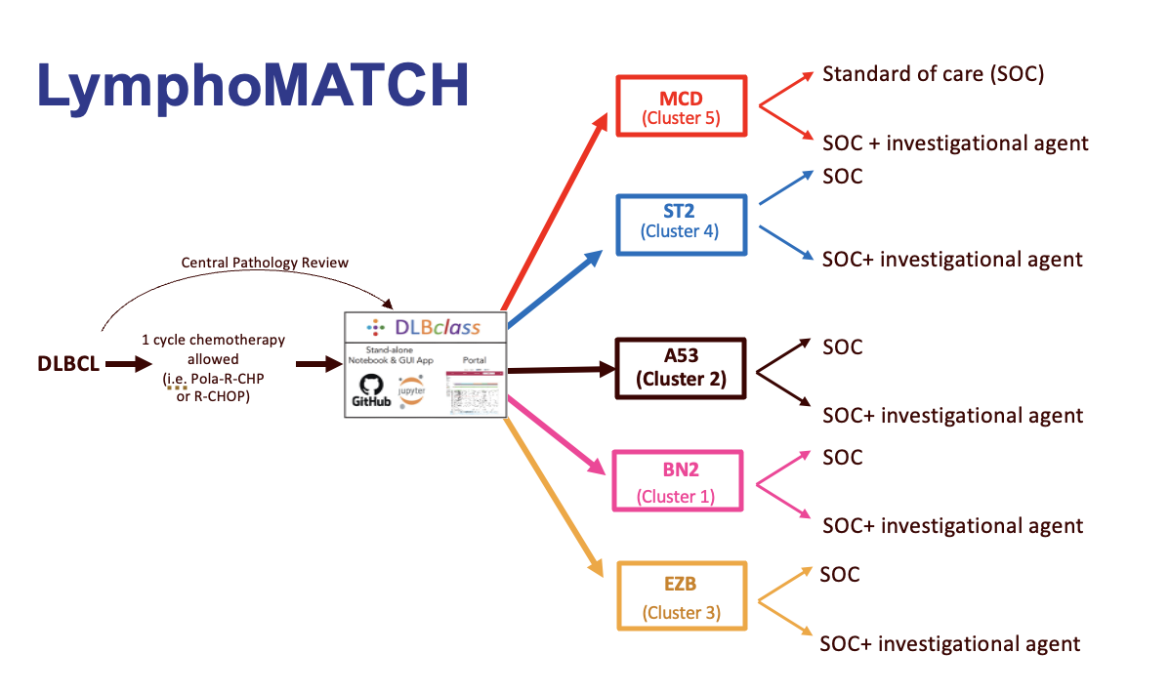
On the horizon for frontline DLBCL: targeted vs. precision approaches
RCHOP plus “X”
Golcadomide
Bispecific agents
glofitamab
epcoritamab odronextamab
Tafasitamab +/- len
Polatuzumab
VS.

Slide 37
Rel/Ref large B-cell lymphoma

Slide 38
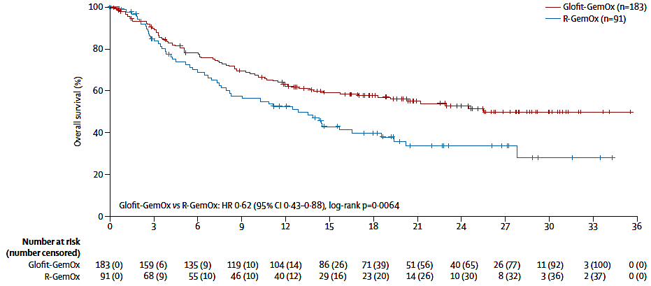
Last year: STARGLO: RP3 Trial of R-GEMOX vs. glofit-GEMOX in rel/ref LBCL
R-GemOx x 8 cycles
Primary endpoint: OS
Med f/u 20.7m
Med OS 25.5m vs 12.9m
(HR 0.62)
Abramson EHA 2024 LB3438; Abramson Lancet 2024

Slide 39
NOW: POLARGLO: Pola-R-GemOx significantly improved OS vs R-GemOx in patients with R/R DLBCL
Median OS follow-up: 24.6 months (95% CI: 23.0–26.0)
Matasar M et al. EHA 2025; Abstract S101.

Slide 40
POLARGLO: Survival benefit seen in both ABC and GCB cell-of-origin subgroups
Matasar M et al. EHA 2025; Abstract S101.

Slide 41
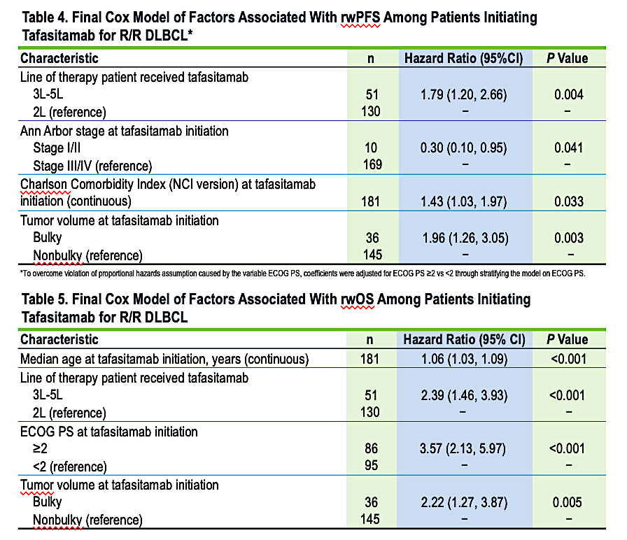
Tafasitamab plus lenalidomide in RR DLBCL (phase 2 trial) and RWE
Body of evidence suggests:
Best for 2L disease
Non-bulky
Good PS
CR
Saverno 2025 Tandem Meetings; Duell Haematologica 2024 Feb 1;109(2):553-566.

Slide 42
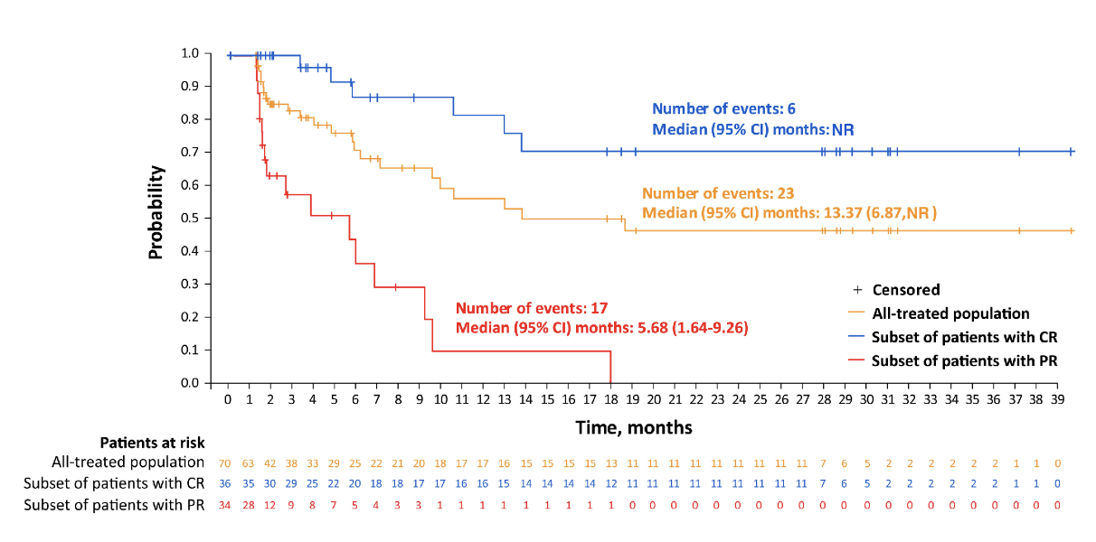
Loncastuximab tesirine: Final analysis of LOTIS-2 trial in rel/ref LBCL (n=145)
LOTIS-5 RP3 Confirmatory Trial Lonca-R vs. R-GemOx:
Regimen: Lonca 150 µg/kg + rituximab 375 mg/m² every 3 weeks (Q3W) for 2 cycles, then Lonca 75 µg/kg + rituximab 375 mg/m² Q3W for up to 6 additional cycles.
Loncastuximab plus rituximab in RR DLBCL completed accrual (press release December 2024)
Safety run-in of 20 pts had ORR 80% (16/20) with CR 50% (10/20) and no new safety signals
LOTIS-7 Lonca plus glofit
ORR 93%, CR 87%, Low CRS (mainly grade 1), Dose-expansion part underway
Kwiatek ASCO 2024 TIP; Caimi Haematologica. 2024 Apr 1;109(4):1184-1193; Alderuccio ICML 2025

Slide 43
Follicular Lymphoma:
treatment other than T-cell engaging approaches
Notes:
Published research findings with approved (mosunetuzumab, epcoritamab) and promising investigational (odronextamab) bispecific antibodies in R/R FL
Published data with tazemetostat in EZH2-mutant and EZH2 wild-type R/R FL
Published data from the Phase II ROSEWOOD study of zanubrutinib in combination with obinutuzumab in patients with FL who had received ≥2 previous systemic therapies
Emerging findings from the Phase III inMIND trial evaluating lenalidomide/rituximab with and without tafasitamab in patients with R/R follicular or marginal zone lymphoma

Slide 44

Treatment options for rel/ref FL
2L Options
Chemo+ Ritux or Obinu
Len + rituximab or obinu
Anti-CD20 monotherapy +/- maintenance
(tazemetostat)
(autoHCT)
3L+ Options
Bispecific antibody
Mosunetuzumab
Epcoritamab
**Odronextamab (not approved)
CAR-T
Axi-cel
Tisa-cel
Liso-cel
Tazemetostat
Zanubrutinib + obin
(alloHCT)
NEW:
Tafa-LenR
Lonca-R

Slide 45
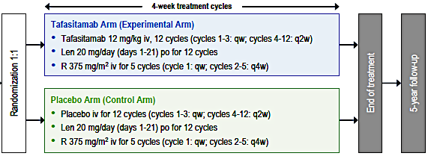
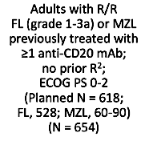
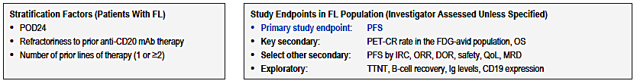
inMIND trial: RP3 double-blind len-rituximab +/- tafasitamab in rel/ref FL
Sehn ICML 2025; Sehn ASH 2024; Abstract LBA-1.

Slide 46
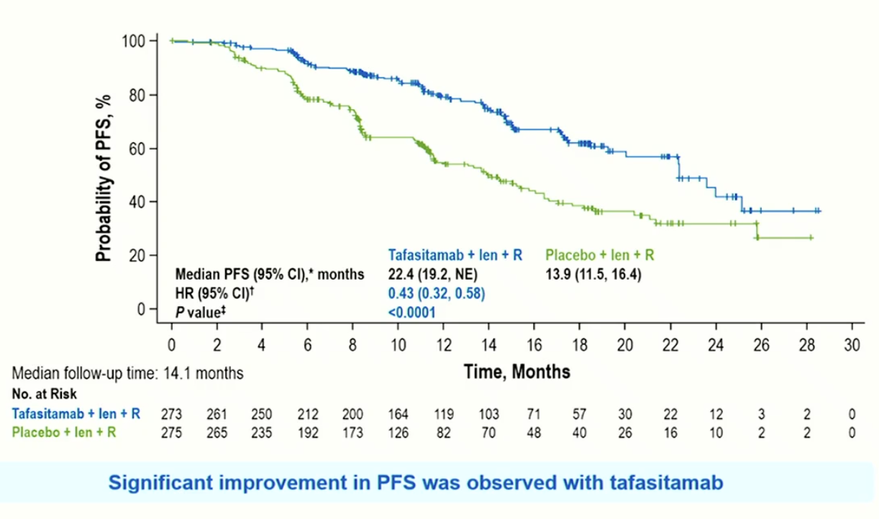
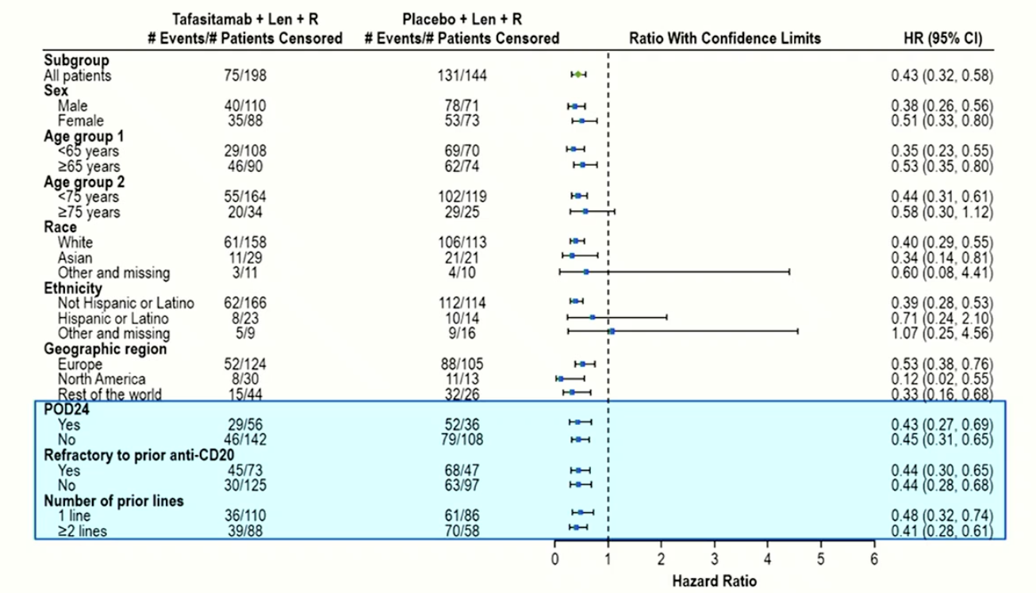
inMIND Results: Tafa-LenR vs. Pbo-LenR
Improved PFS, DoR, TTNT for Tafa-LenR
NOTE: 23/24 post-treatment lymphoma samples retained CD19 expression
Sehn ICML 2025

Slide 47
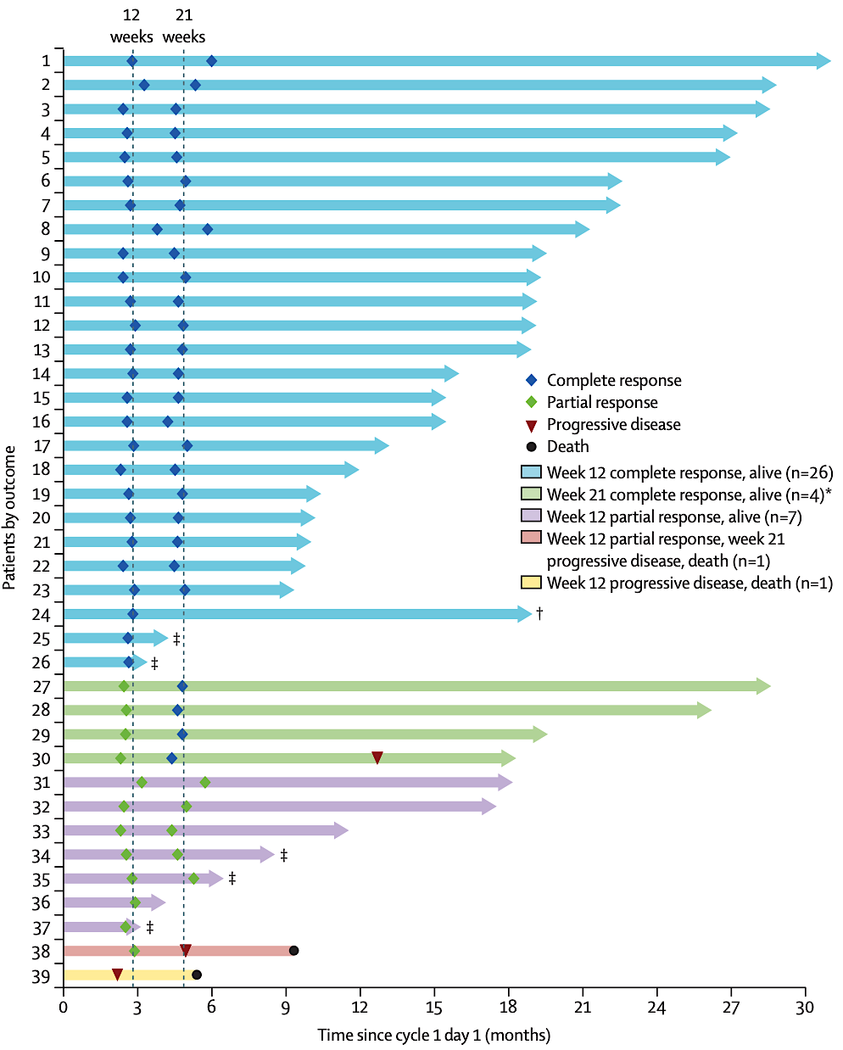
Lonca plus rituximab in RR FL (phase 2) n=39
Short follow up
Patients with 51% early POD
CR 67%
TEAEs: lymphopenia, neutropenia, generalized and peripheral edema
Added to NCCN Guidelines as other recommended regimen in third line and beyond for FL (v3.2025, category 2B)
Alderuccio Lancet Haematol 2025; 12: e23–34

Slide 48
ROSEWOOD: RP2 (2:1) trial of Zanu-obin vs. obin in RR FL
Zinzani JCO 41(33) https://doi.org/10.1200/JCO.23.00775

Slide 49
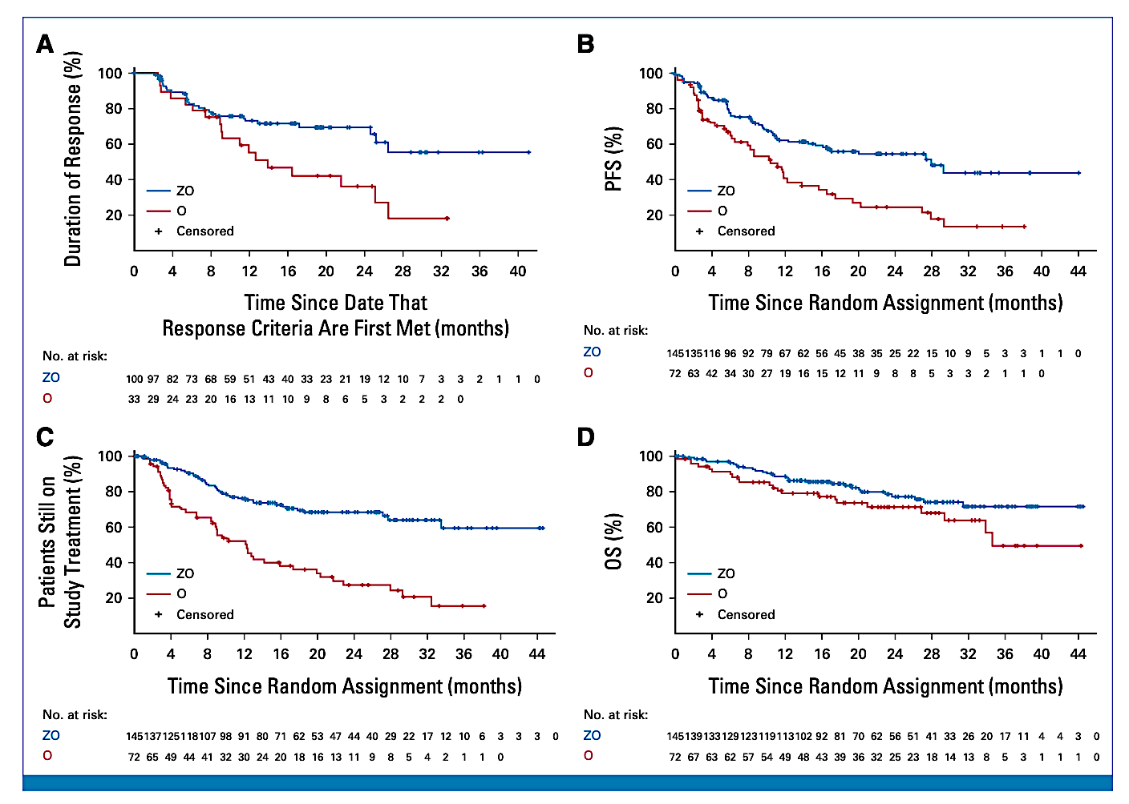
ROSEWOOD: RP2 (2:1) Zanu-obin versus obin
ASH 2024 Update:
Post-hoc analysis of data from ROSEWOOD showed that the majority (>60%) of patients with R/R FL receiving ZO had a significant improvement in PFS vs their last prior tx, irrespective of the number of prior lines (only 2 or >2) and in all tested subgroups of high clinical interest
Trotman ASH 2024; Zinzani JCO 41(33) https://doi.org/10.1200/JCO.23.00775

Slide 50
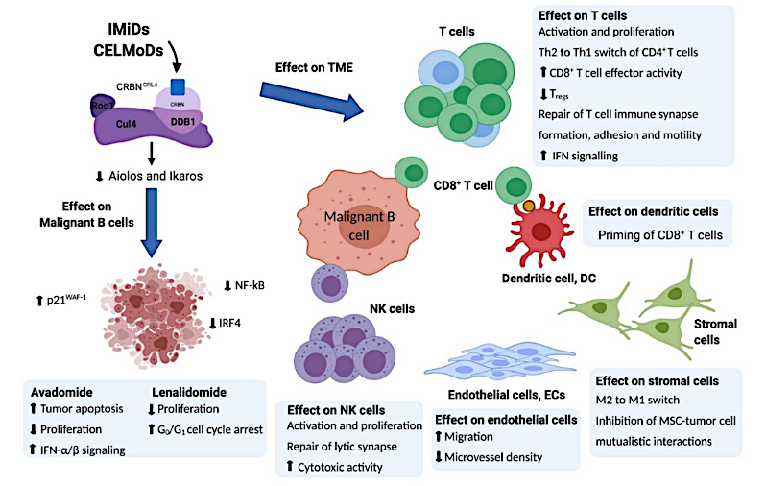
Emerging agents: CELMoDs
CELMoDs:
Avadomide
Iberdomide
Golcadomide
Mezigdomide
Ongoing trials:
Golca plus RCHOP/pola-RCHP
Golca post CAR-T
Side effects:
Cytopenias, hyperglycemia, electrolyte abnormalities
Ioannou N et al. Int J Mol Sci 2021 Aug 9;22(16):8572.

Slide 51
Data + Perspectives: Clinical Investigators Explore the Application of Recent Datasets in Current Oncology Care
CME/MOC, NCPD and ACPE Accredited
Saturday, October 11, 2025
7:15 AM – 12:30 PM ET

Slide 52
Questions from General Medical Oncologists
For which patients with DLBCL do you use polatuzumab vedotin + R-CHP as up-front treatment?

Slide 53
Questions from General Medical Oncologists
How are BTK inhibitors being evaluated in DLBCL? If these agents are proven effective in the first-line in non-GCB subtype, how will you select between them and pola-R-CHP?
Where are you currently considering the use of zanubrutinib/obinutuzumab for R/R FL?

Slide 54
Questions from General Medical Oncologists
How are you using tafasitamab in DLBCL?
Is tafasitamab in combination with R² now your usual second-line therapy?

Slide 55
Questions from General Medical Oncologists
How are you incorporating loncastuximab tesirine into your current management of DLBCL?
Given lonca-T has now been added to NCCN for FL, where are you thinking about using it in relation to zanu/obin or tazemetostat?
What are the common toxicities of loncastuximab tesirine? How are these prevented and mitigated?
Are you comfortable using all three CD19 directed approaches in the same patient? How will we potentially integrate a 4th?

Slide 56
Questions from General Medical Oncologists
In general, how do you sequence agents for patients with FL and POD24 (disease progression within 24 months of initial treatment)?

Slide 57

Save The Date
A Multitumor CME/MOC-, NCPD- and ACPE-Accredited Educational Conference Developed in Partnership with Florida Cancer Specialists & Research Institute
Friday to Sunday, April 24 to 26, 2026
The Ritz-Carlton Orlando, Grande Lakes | Orlando, Florida
Moderated by Neil Love, MD

Slide 58
Thank you for joining us!
Your feedback is very important to us.
Please complete the survey currently up on the iPads for attendees in the room and on Zoom for those attending virtually. The survey will remain open up to 5 minutes after the meeting ends.
How to Obtain Credit
In-person attendees: Please refer to the program syllabus for the CME/MOC, NCPD and ACPE credit link or QR code.
Online/Zoom attendees: The CME/MOC, NCPD and ACPE credit link is posted in the chat room.

