Slide 1
Data + Perspectives: Clinical Investigators Explore the Application of Recent Datasets in Current Oncology Care CME/MOC, NCPD and ACPE Accredited
Saturday, October 11, 2025 7:15 AM – 12:30 PM ET

Slide 2
Agenda
Module 1 — Breast Cancer: Drs Burstein, Goetz, McArthur and Nanda
Module 2 — Prostate Cancer: Drs Antonarakis and M Smith
Module 3 — Colorectal Cancer: Drs Lieu and Strickler
Module 4 — Diffuse Large B-Cell Lymphoma and Follicular Lymphoma: Drs Lunning and S Smith

Slide 3


Colorectal Cancer Faculty
Christopher Lieu, MD
Professor of Medicine
Associate Director for Clinical Research
Director, GI Medical Oncology
University of Colorado Cancer Center
Aurora, Colorado
John Strickler, MD
Professor of Medicine
Associate Director, Clinical Research – GI
Co-Leader, Molecular Tumor Board
Duke University
Durham, North Carolina

Slide 4



Current and Future Role of Immune Checkpoint Inhibitors in the Management of Colorectal Cancer
Christopher Lieu, MD Director, GI Medical Oncology
Associate Director for Clinical Research
University of Colorado

Slide 5
Topics for Discussion
Neoadjuvant and adjuvant immune checkpoint inhibitors for MSI-H/dMMR colon and rectal cancers
Should immunotherapy go first, or after surgery?
Immunotherapy in the first-line setting for MSI-H/dMMR colorectal cancer
Is doublet better than single-agent?
Immunotherapy for MSS/pMMR metastatic colorectal cancer

Slide 6
Immune checkpoint inhibitors for patients with non-metastatic rectal cancer

Slide 7
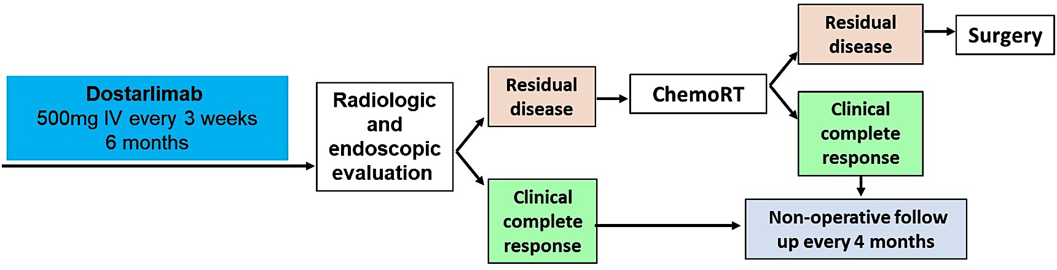
Dostarlimab for MSI-H Stage II-III Rectal Cancer
n=30
Primary endpoints
Overall response rate at 6 months per MSKCC regression criteria
pCR or cCR rate at 12 months
Secondary endpoint
Safety and tolerability
Cercek A, et al. N Engl J Med 2022.

Slide 8
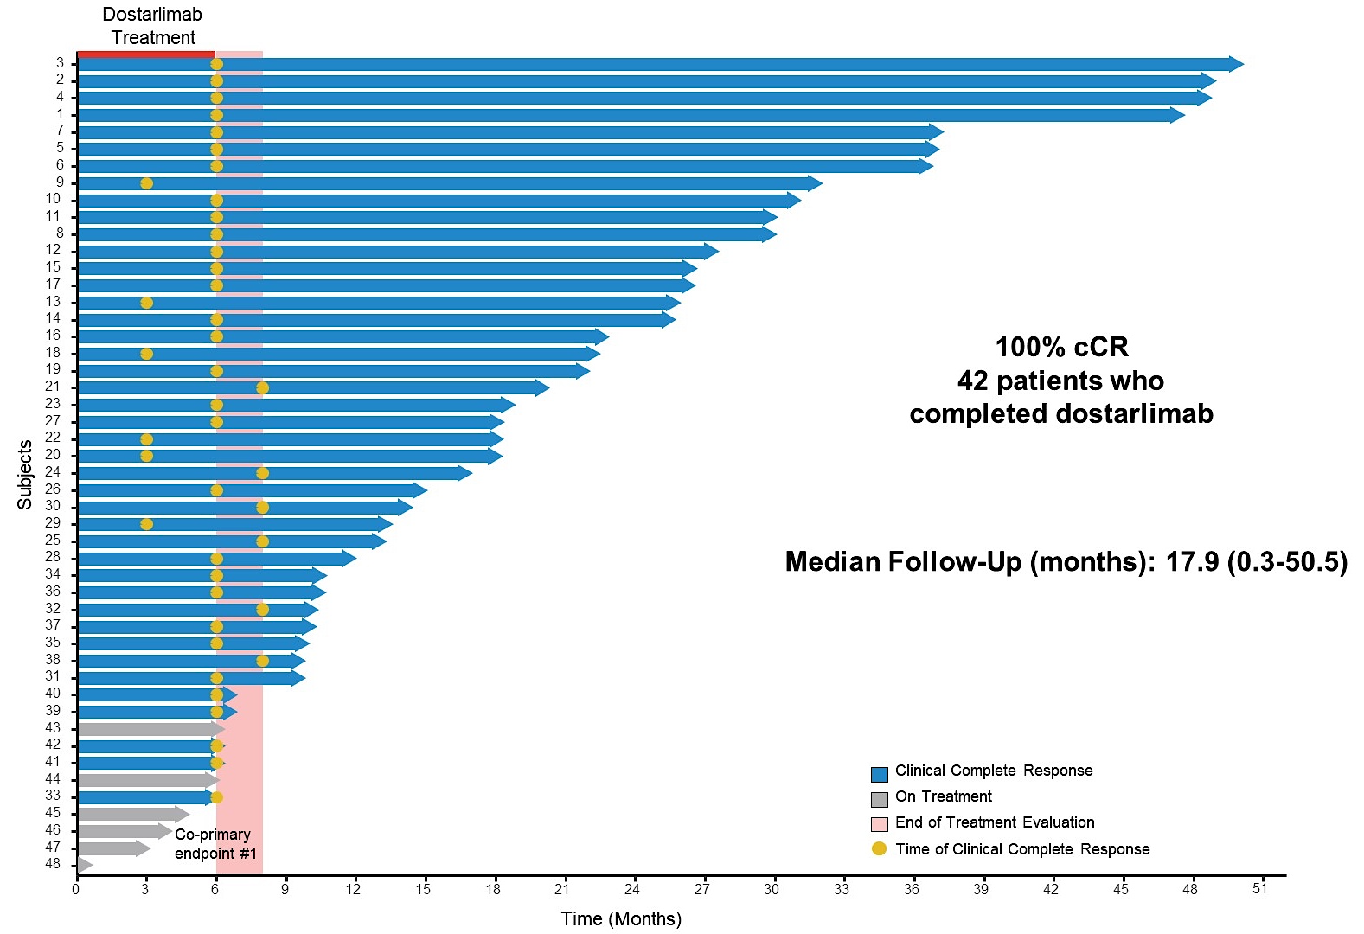

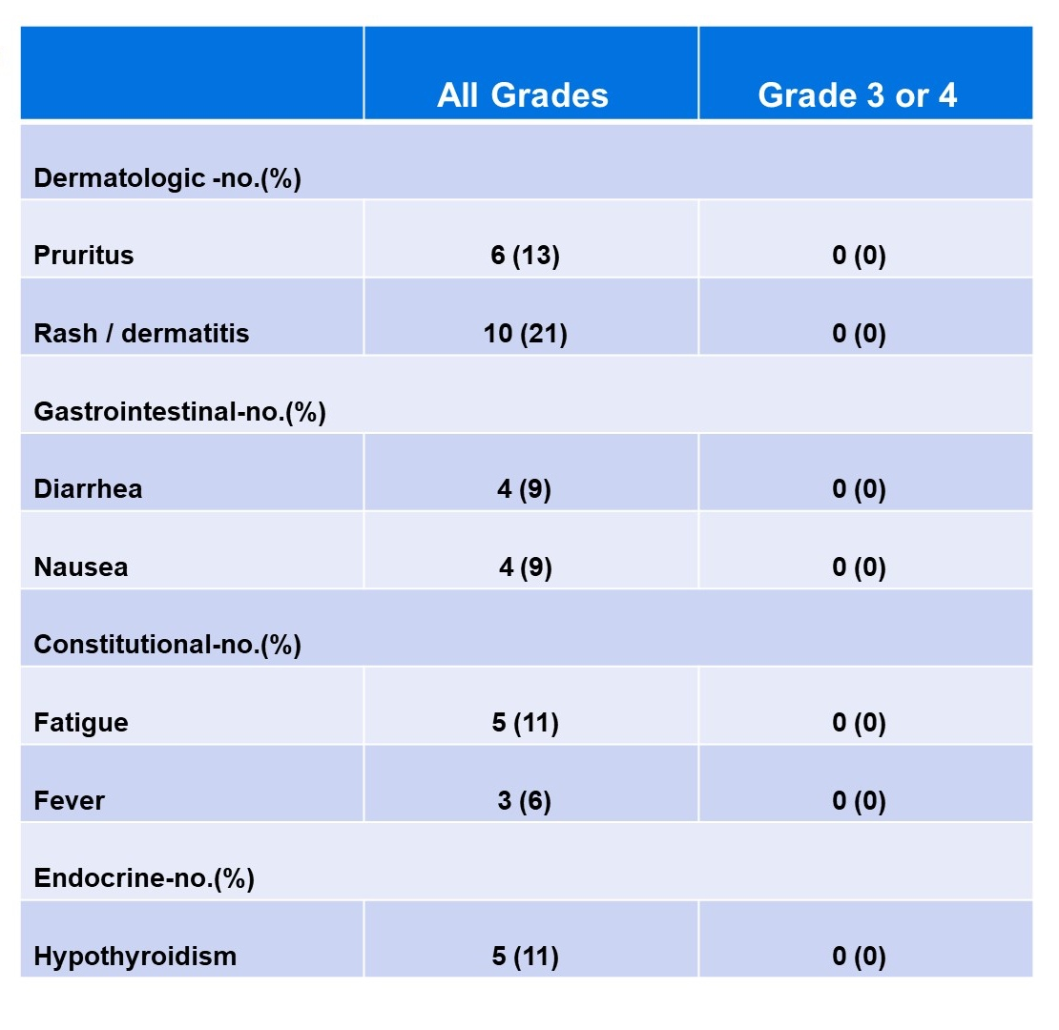
Cercek A et al. NEJM 2022, Cercek A et al. ASCO 2024;Abstract LBA3512

Slide 9
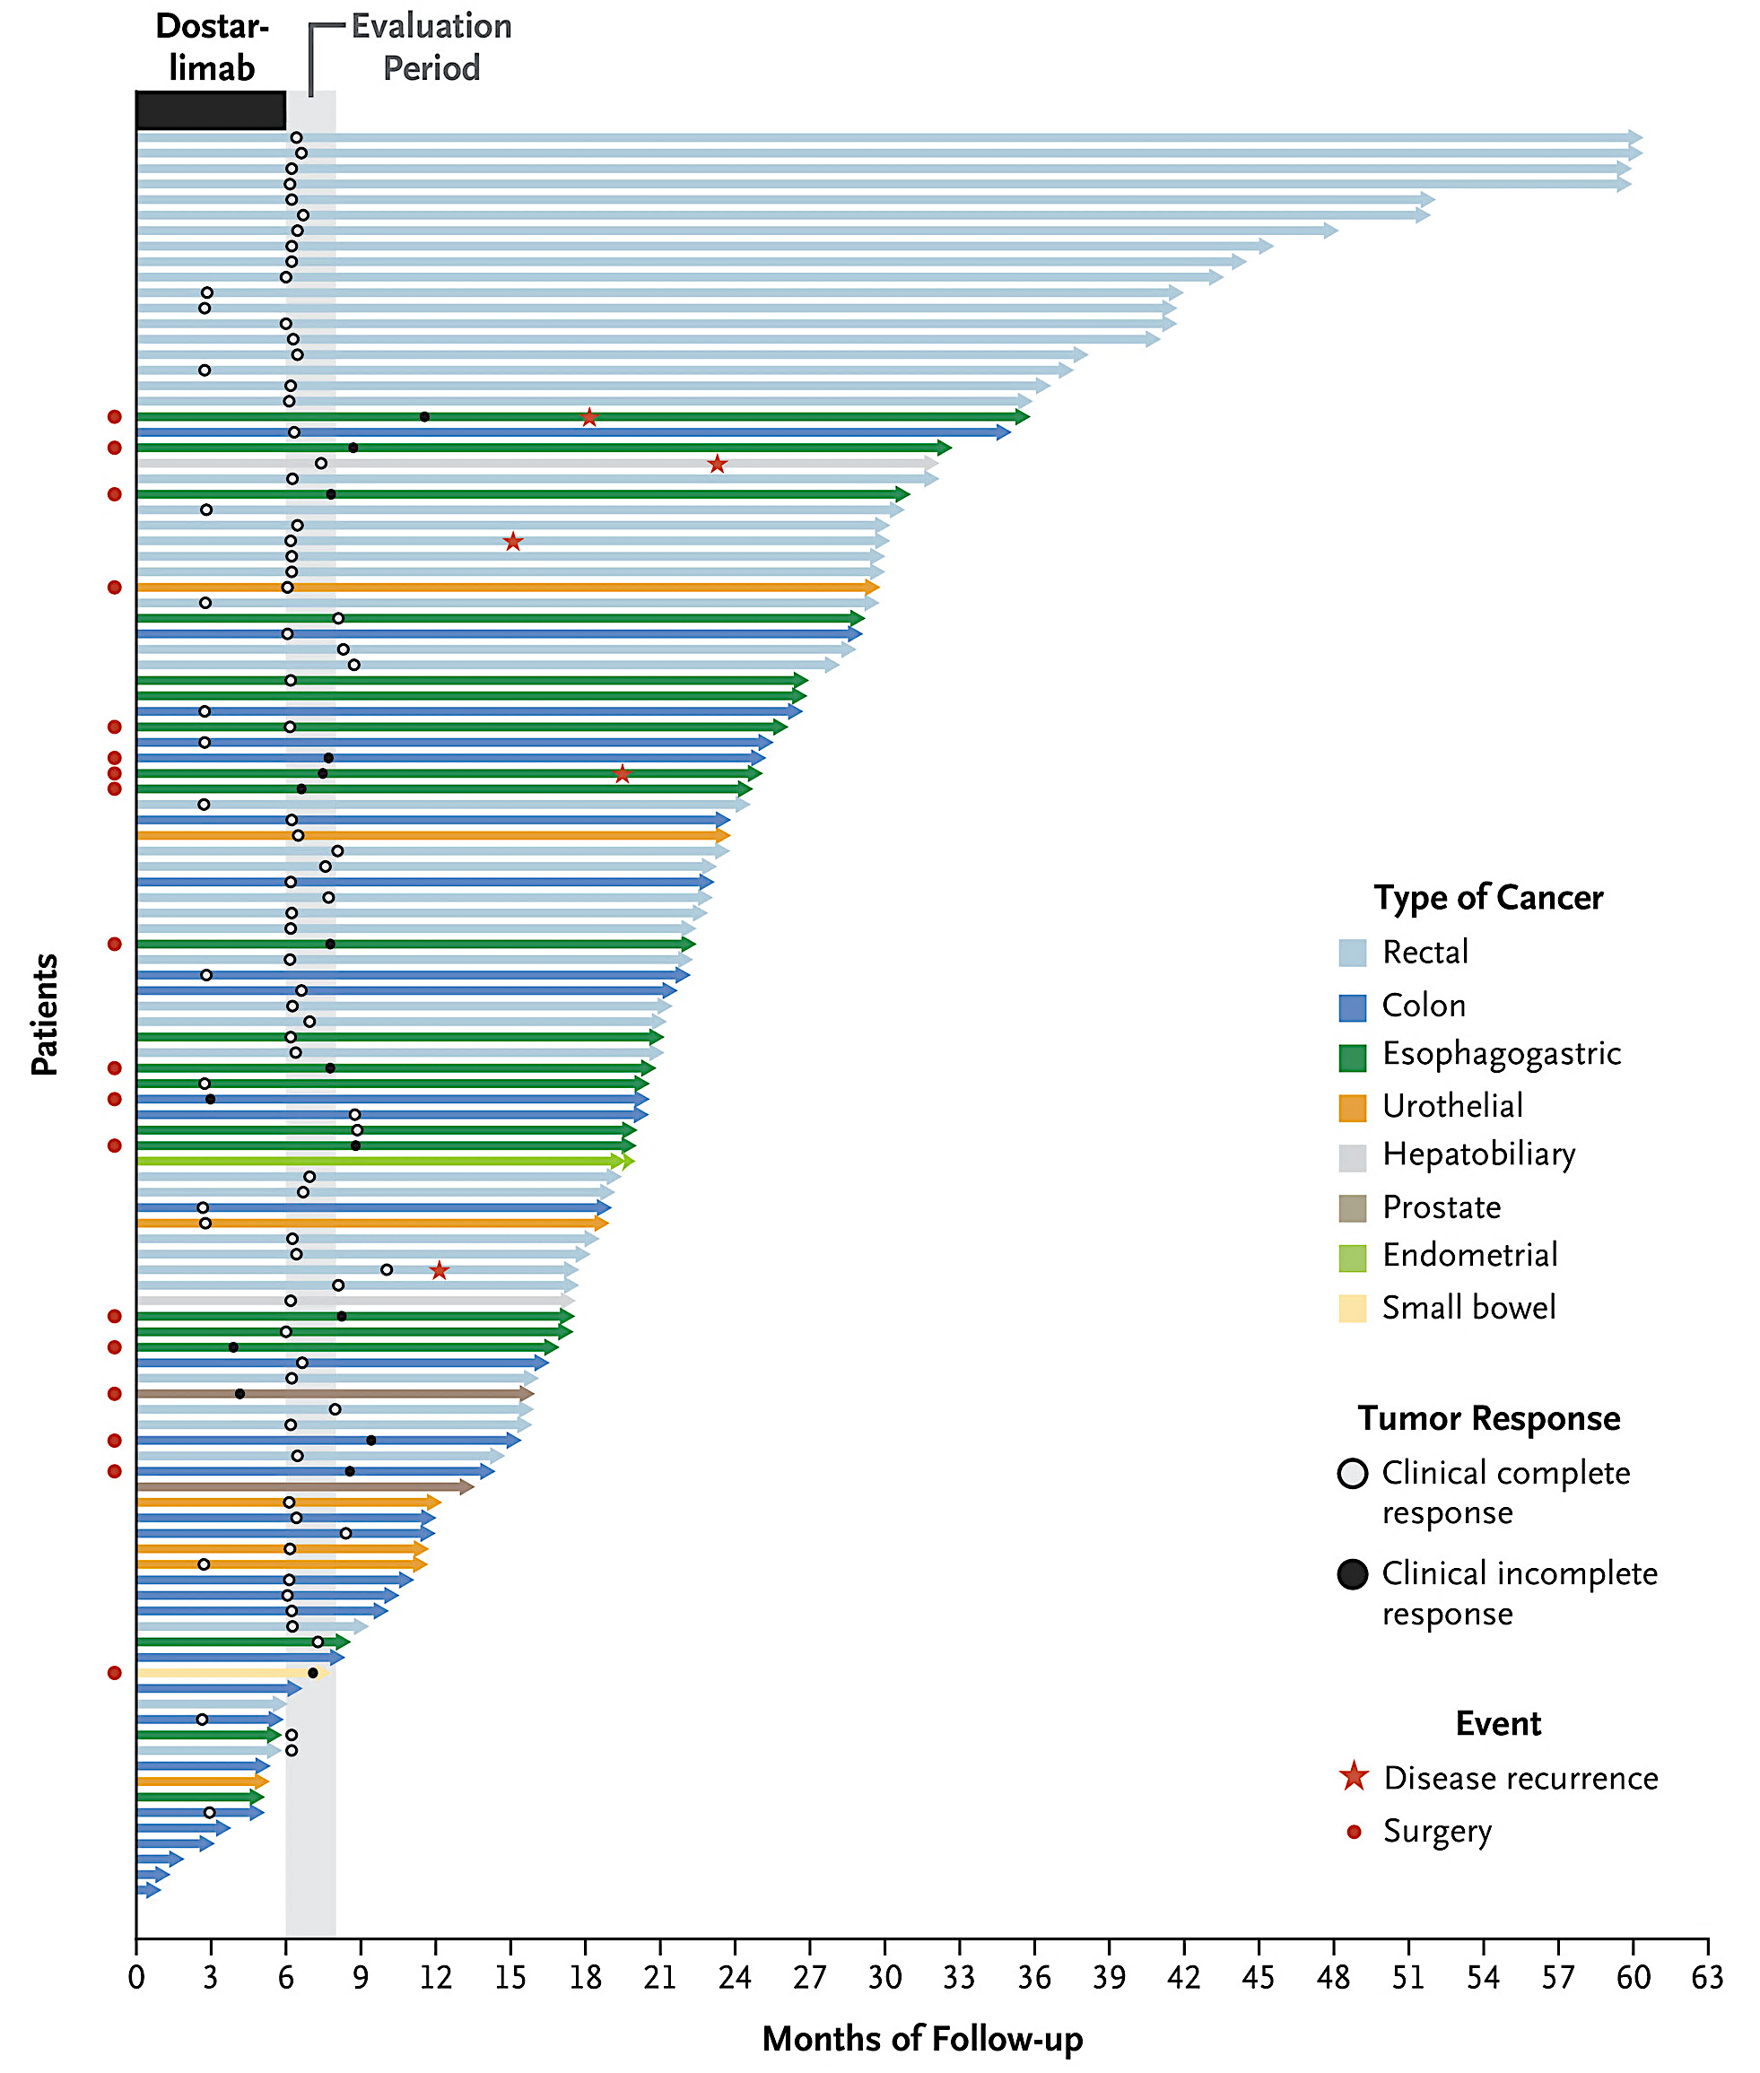
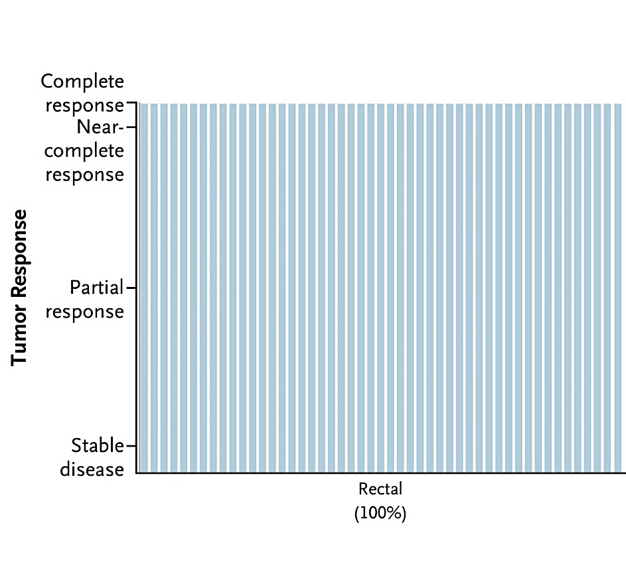
Dostarlimab for MSI-H
Stage II-III Rectal Cancer
Updated data (2025)
Cercek A et al. N Engl J Med 2025.

Slide 10
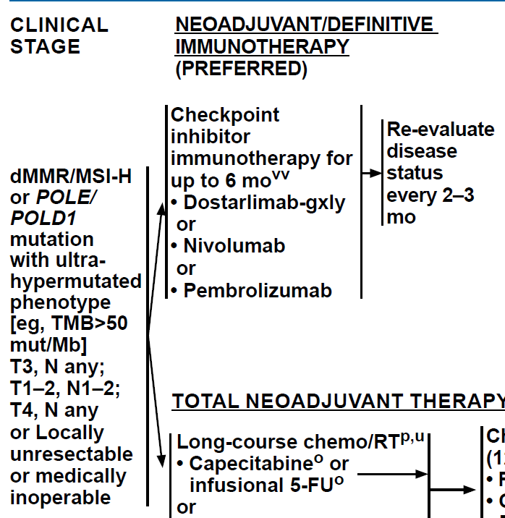
Take Home Points:
Neoadjuvant immune checkpoint inhibition appears ready for primetime for rectal dMMR/MSI-H
QUESTIONS:
What about stage I rectal cancer?
Should we be using nivo/ipi?
Does pCR mean cure?
What is the impact of immunotherapy on pMMR/MSS rectal cancer?
TOTAL NEOADJUVANT THERAPY
NCCN Rectal Cancer Guidelines. Version 4.2025

Slide 11
AZUR-1: Dostarlimab in dMMR/MSI-H Locally-Advanced Rectal Cancer
NCT05723562

Slide 12
Immune checkpoint inhibitors for patients with non-metastatic colon cancer

Slide 13
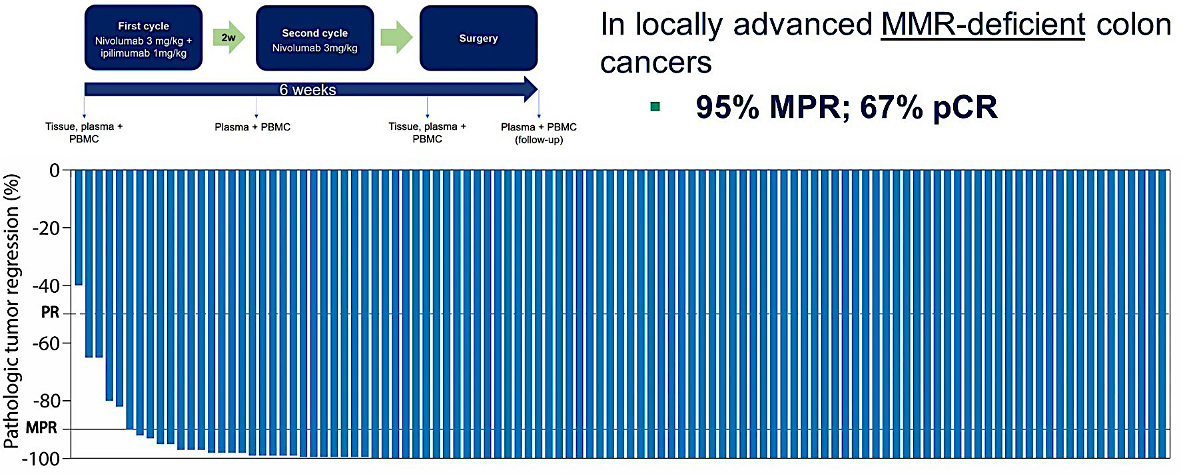
NICHE-2 Study: Nivo/Ipi dMMR colon cancer
Chalabi M et al. ESMO 2022;Abstract LBA7

Slide 14
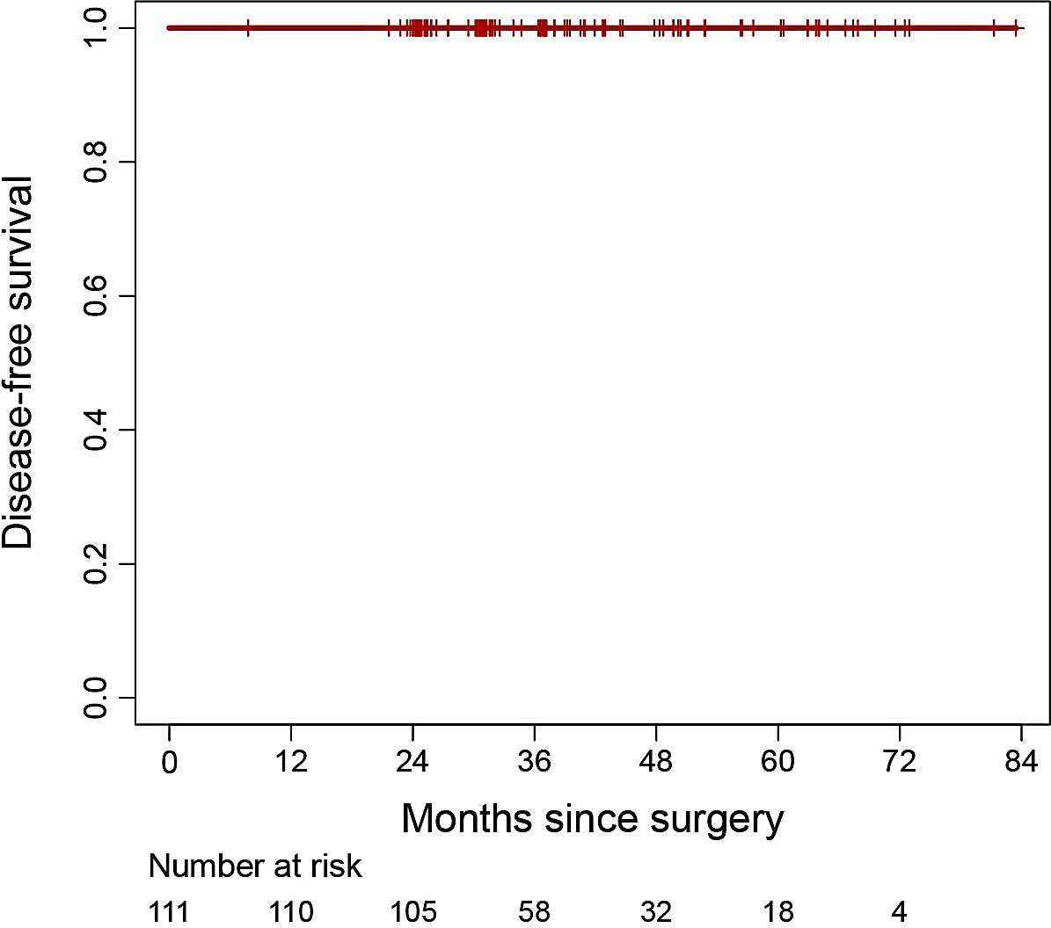

Results – 3-year disease-free survival 100%
100% 3-year DFS
Median follow-up after surgery: 36.6 months (7.8 - 83.4)
Myriam Chalabi, MD PhD Content of this presentation is copyright and responsibilit
y of the author. Permission is required for re-use.
Chalabi M et al. ESMO 2024;Abstract LBA24
Data cut-off: 11 September 2024

Slide 15
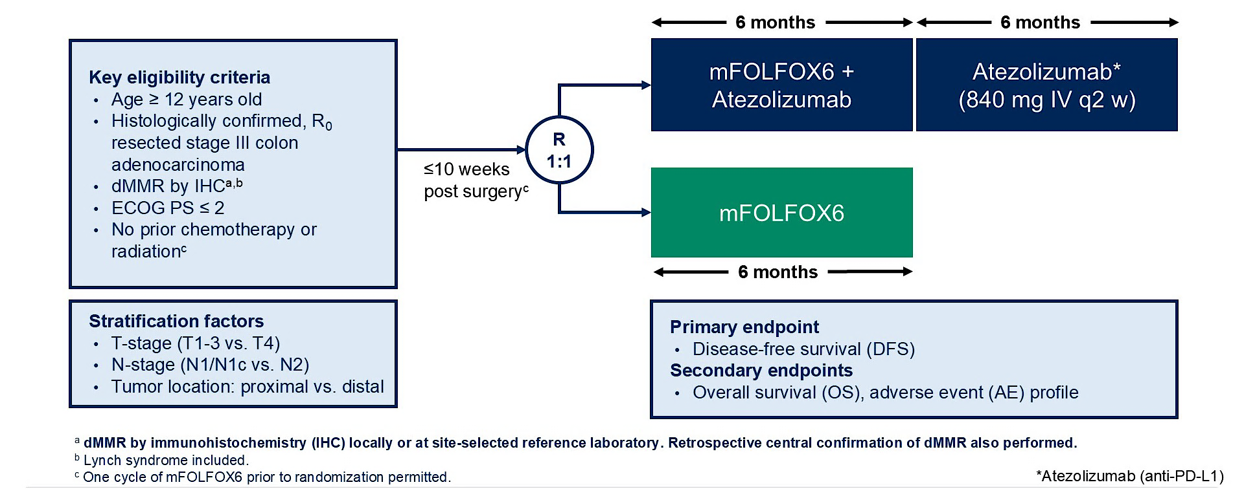
ATOMIC: addition of atezolizumab to standard chemotherapy for dMMR/MSI-H colon cancer
NCT02912559

Slide 16
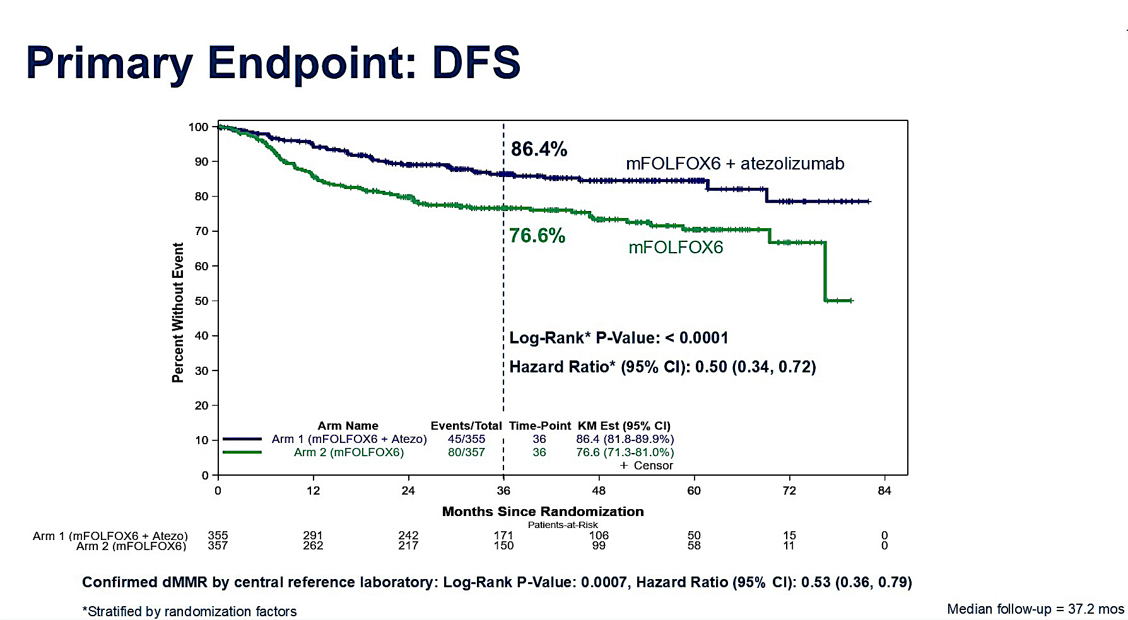
Sinicrope FA et al. ASCO 2025;Abstract LBA1

Slide 17
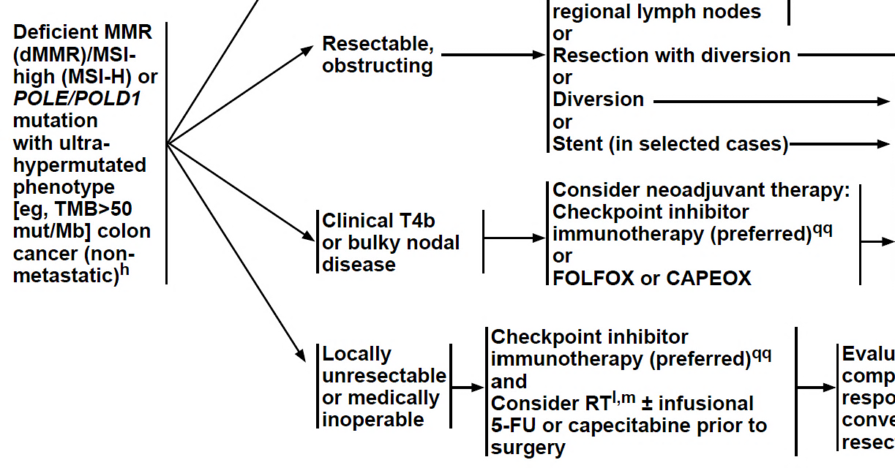
Take Home Points:
Neoadjuvant immune checkpoint inhibition should be considered for high-risk disease (T4b/bulky nodal disease) colon cancer
FOLFOX/atezolizumab is the new standard in patients not receiving neoadjuvant therapy!
QUESTIONS:
Should we consider non-operative management for MSI-H/dMMR colon cancer?
Are serial colonoscopies better or worse than a hemicolectomy?
What is the best duration of immunotherapy prior to resection?
Is there a role for immunotherapy in pMMR/MSS colon cancer?
NCCN Colon Cancer Guidelines. Version 4.2025

Slide 18






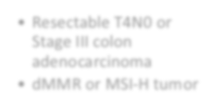










AZUR-2: An Ongoing Phase III Study of Perioperative Dostarlimab for Untreated T4N0 or Stage III dMMR/MSI-H Resectable Colon Cancer
Trial identifier: NCT05855200
Dostarlimab Surgery Dostarlimab
Key inclusion criteria
Resectable T4N0 or Stage III colon adenocarcinoma
dMMR or MSI-H tumor
N = 711
(1:1)
Key exclusion criteria
Placebo
Surgery
CAPEOX/FOLFOX
Prior chemotherapy, IO, biological or targeted therapy, RT, or surgery for colon cancer
History of ILD or
pneumonitis
Allogeneic stem cell transplant
Any major surgery or injury within 28 days of enrollment
Outcomes
Primary endpoint: EFS up to 5 years
Key secondary endpoints: OS up to 5 years, pCR, safety
dMMR = defective mismatch repair; MSI-H = microsatellite instability high; IO = immunotherapy; RT = radiation therapy; ILD = interstitial lung disease; CAPEOX = capecitabine/oxaliplatin; FOLFOX = fluorouracil/leucovorin/oxaliplatin;
EFS = event-free survival; OS = overall survival; pCR = pathological complete response
www.clinicaltrials.gov. Accessed January 2024.

Slide 19
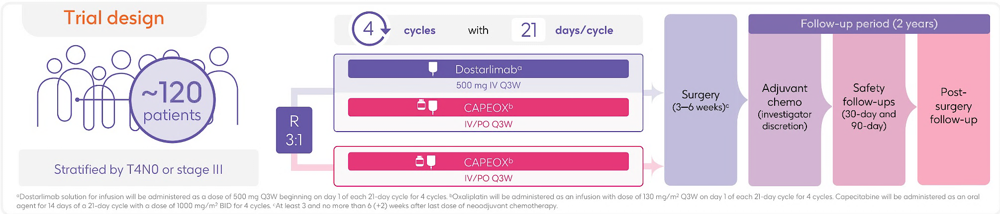
AZUR-4: randomized study of neoadjuvant dostarlimab plus CAPEOX vs CAPEOX in untreated T4N0 or stage III in pMMR/MSS colon cancer
Primary Endpoints:
Major pathological response (≤ 10% residual viable tumor)
Safety
Secondary Endpoints:
Primary tumor resection exclusion
Pathological response
Rasschaert G et al. ASCO 2025;Abstract TPS3649

Slide 20
Immunotherapy in the first-line treatment of mCRC MSI-H/dMMR

Slide 21
Phase III RCTs of Immunotherapy vs Chemotherapy as First-Line Therapy for dMMR/MSI-H mCRC
KEYNOTE-177
Checkmate 8HW
Pembro
Nivo + Ipi
100
CT
100
CT
71 (95% CI, 64-77)
80
80
+
+
63 (95% CI, 56-70)
+
+
+
+
+
+
+
+
+
+
+
+
+
+
+
+
+
+
+
+
+
+
+
+
+
+
+
+
+
+
+
+
60
+
+
+
+
+
+
+
+
60
+
+
+
+
+
+
+
+
+
+
+
+
+
+
+
+
+
+
+
PFS (%)
Patients (%)
+
40
40
24 (95% CI, 14-34)
55%
38%
42%
11%
15 (95% CI, 7-25)
20
20
0
0
0
4
8
12
16
20
24
28
32
36
40
44
48
52
56
60
0
3
6
9
12
15
18
21
24
27
30
33
36
39
42
45
Mo
Months
André T et al. ASCO 2021;Abstract 3500. André T et al. N Engl J Med. 2024;391(21):2014-2026.
Notes:
CRC, colorectal cancer.

Slide 22
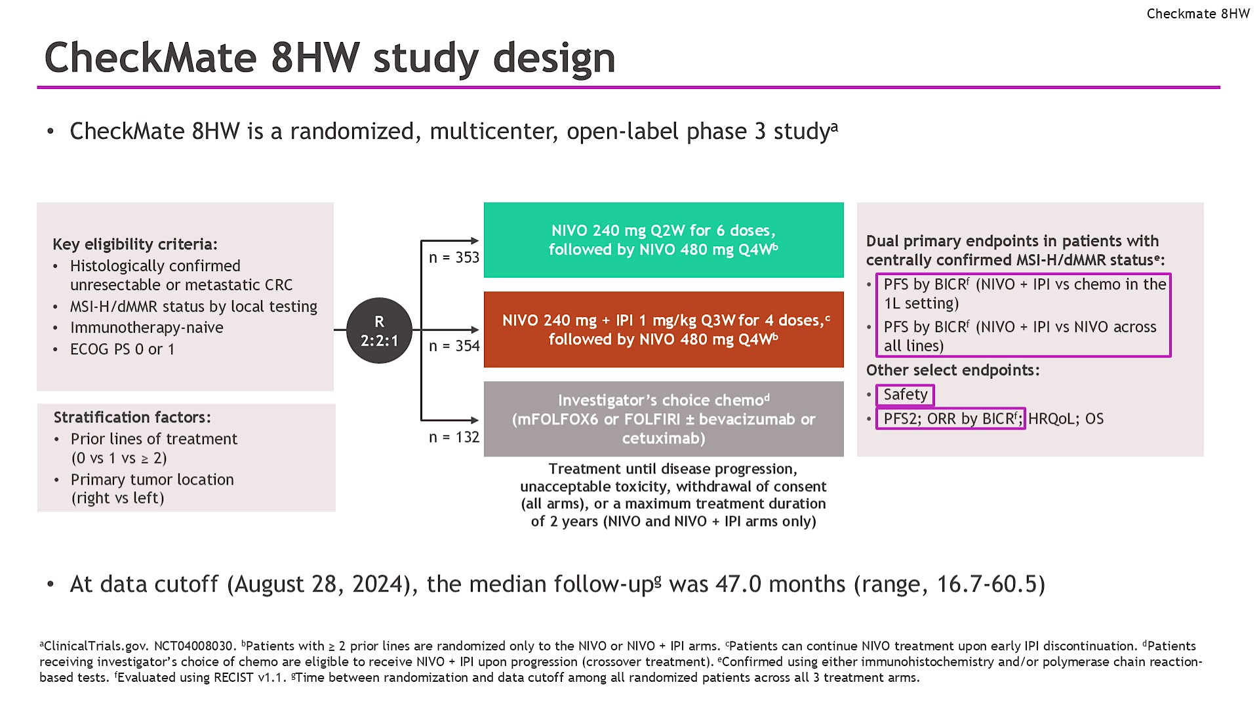
Lenz HJ et al. ASCO 2024. Abstract 3503.

Slide 23
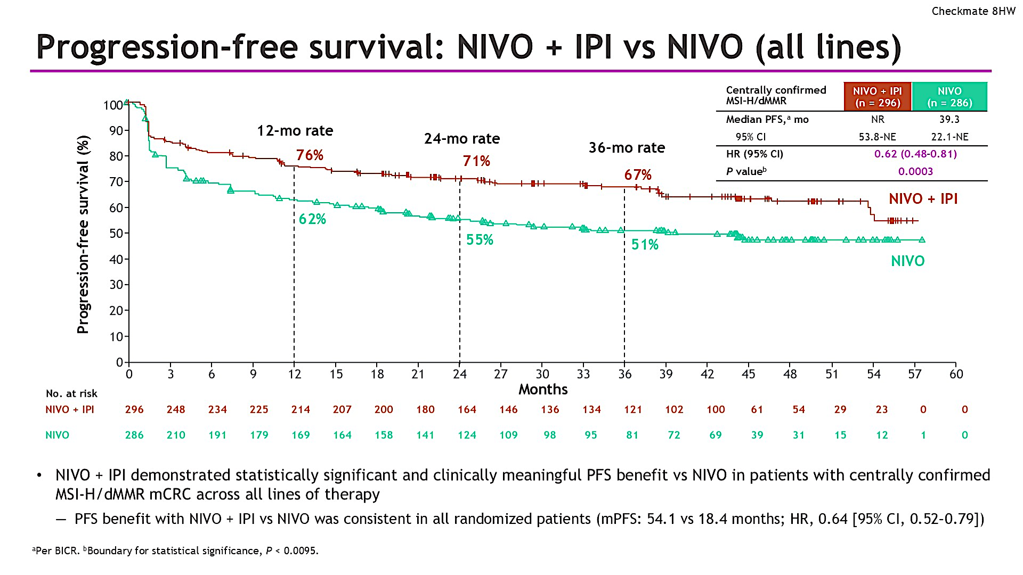
Andre T et al. ASCO GI 2025. Abstract LBA143.

Slide 24
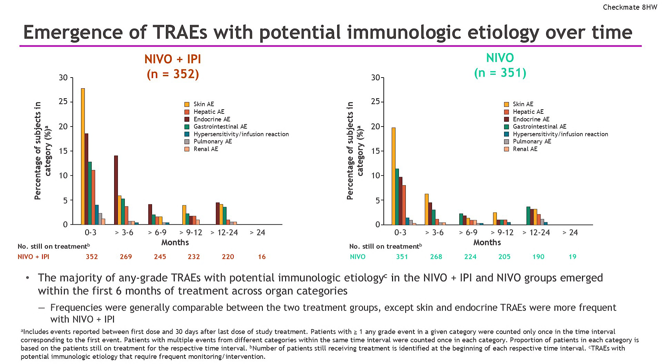
Lenz HJ et al. ASCO 2025. Abstract 3501.

Slide 25
TAKE HOME POINT: Patients with mCRC and MSI-H and/or dMMR should receive immunotherapy in the frontline setting In eligible patients, strongly consider dual immunotherapy with nivolumab and ipilimumab

Slide 26
Is there a role for immunotherapy in pMMR/MSS mCRC?

Slide 27
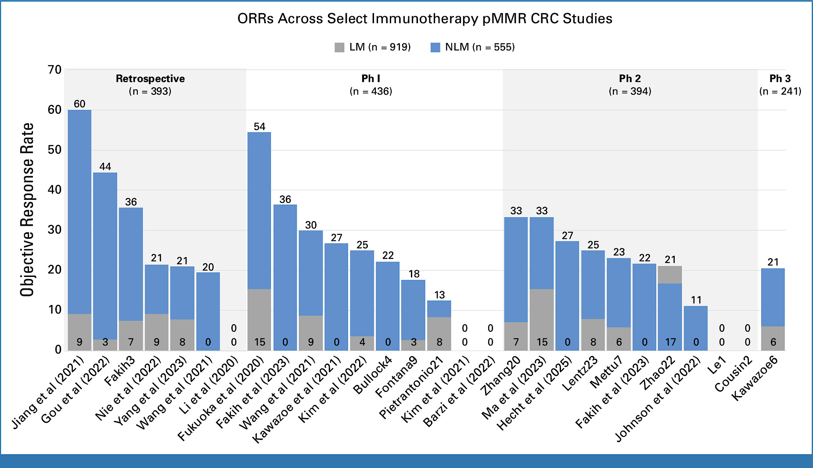
Response Rates in non-liver vs liver mCRC
Beiter ER et al. J Clin Oncol 2025

Slide 28


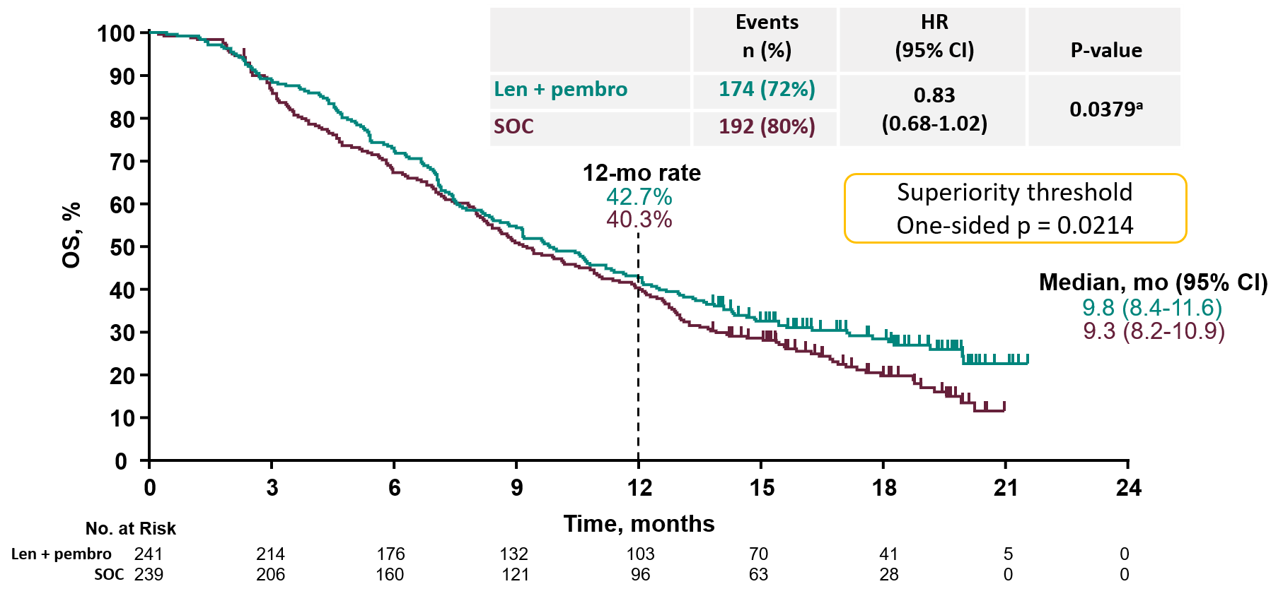



LEAP-017: Lenvatinib/Pembro
OS
Events/Patients, N HR or ORR (95%CI)
PFS
RR
Primary Endpoint OS: NEGATIVE
Kawazoe A et al. 2023 ESMO World GI Cancer Congress. Abstract LBA-5
Kawazoe A et al. J Clin Oncol. 2024 Aug 20;42(24):2918-2927.

Slide 29
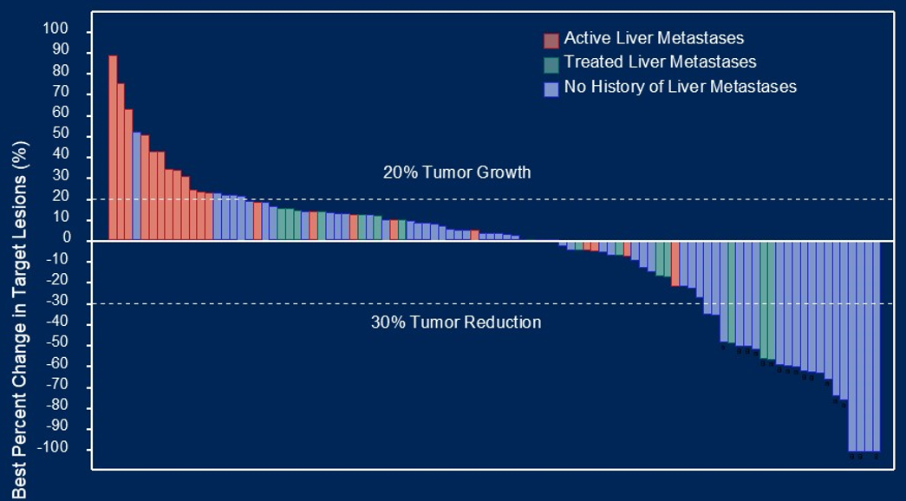
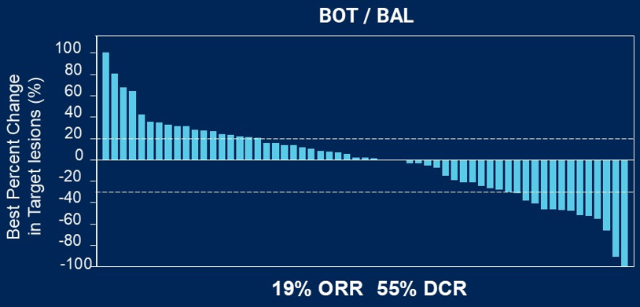
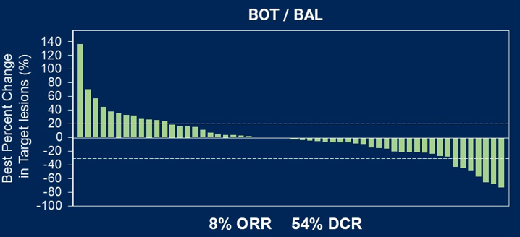
Botensilimab + Balstilimab in Non-liver Met pMMR mCRC
Fc-enhanced CTLA-4 Inhibitor (BOT) and PD-1 Inhibitor (BAL)
Phase 1 Trial
Randomized Phase 2 Trial
BOT
75mg
Non-liver met mCRC
BOT
150mg
Bullock AJ et al. Nat Med. 2024;30(9):2558-2567. Fakih M et al. ASCO GI 2025; Abstract 23.

Slide 30
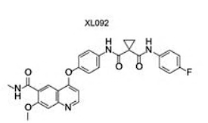
STELLAR-303: Phase 3 Randomized, Open-Label Study of Zanzalintinib (XL092) With Atezolizumab vs Regorafenib in mCRC
Patient population
MSS/MSI-low CRC
Must have received SOC for mCRC and radiographically progressed/be refractory or intolerant to these therapies
Progression during treatment or within 4 months of most recent therapy
Zanzalintinib + Atezolizumab
Zanzalintinib orally daily + atezolizumab IV every 3 weeks
Co-Primary Endpoint
OS in all & NLM patients
Key Secondary Endpoints
PFS by investigator ORR by investigator DOR by investigator
N = ~874#
R 1:1
Regorafenib
Orally daily, 3 weeks on, 1 week off
#Enrollment of patients with liver metastases will be capped at approximately 524
Kinase | Kinase Inhibition
MET | 3.0 ± 0.27
VEGFR2 | 15.0 ± 0.95
AXL | 5.8 ± 0.38
MER | 0.6 ± 0.054
TYRO3 | NA
Saeed A et al. Future Oncol. 2024;20(24):1733-1743.

Slide 31
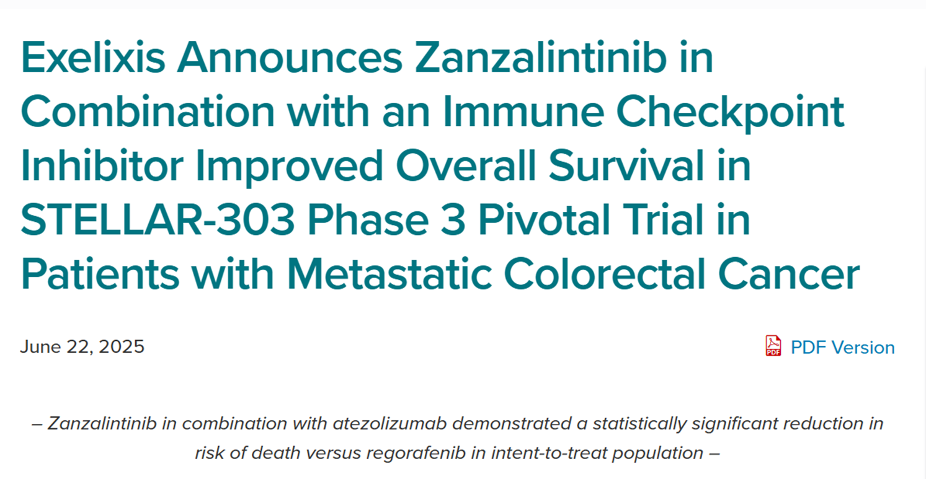
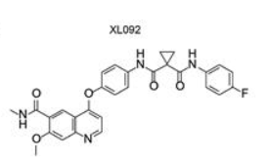
STELLAR-303: Phase 3 Randomized, Open-Label Study of Zanzalintinib (XL092) With Atezolizumab vs Regorafenib in mCRC
Patient population
MSS/MSI-low CRC
Must have received SOC for mCRC and radiographically progressed/be refractory or intolerant to these therapiesX
Progression during treatment or within 4 months of most recent therapy
Zanzalintinib in Combination with an Immune Checkpoint Inhibitor Improved Overall Survival in STELLAR-303 Phase 3 Pivotal Trial in Patients with Metastatic Colorectal Cancer
Zanzalintinib + Atezolizumab
Zanzalintinib orally daily + atezolizumab IV every 3 weeks
Co-Primary Endpoint
OS in all & NLM patients
Key Secondary Endpoints
PFS by investigator ORR by investigator DOR by investigator
N = ~874#
R 1:1
Regorafenib
Orally daily, 3 weeks on, 1 week off
#Enrollment of patients with liver metastases will be capped at approximately 524
Kinase | Kinase Inhibition
MET | 3.0 ± 0.27
VEGFR2 | 15.0 ± 0.95
AXL | 5.8 ± 0.38
MER | 0.6 ± 0.054
TYRO3 | NA
Saeed A et al. Future Oncol. 2024;20(24):1733-1743.
https://ir.exelixis.com/news-releases/news-release-details/exelixis-announces-zanzalintinib-combination-immune-checkpoint

Slide 32
TAKE HOME POINT: STELLAR-303: Phase 3 Randomized, Open-Label Study of Zanzalintinib (XL092) With Atezolizumab vs Regorafenib in mCRC Stay tuned!

Slide 33
Data + Perspectives: Clinical Investigators Explore the Application of Recent Datasets in Current Oncology Care CME/MOC, NCPD and ACPE Accredited
Saturday, October 11, 2025 7:15 AM – 12:30 PM ET

Slide 34
Nivolumab plus Ipilimumab vs Nivolumab Monotherapy for Microsatellite Instability-High/Mismatch Repair-Deficient (MSI-H/dMMR) Metastatic Colorectal Cancer (mCRC): New Results from CheckMate 8HW
Lonardi S et al.
ESMO 2025;Abstract LBA29.
PROFFERED PAPER| MONDAY, OCTOBER 20 | 8:30 CEST

Slide 35
Zanzalintinib plus Atezolizumab (zanza + atezo) vs Regorafenib (rego) in Patients (pts) with Previously Treated Metastatic Colorectal Cancer (mCRC): Primary Overall Survival (OS) Analysis from the Randomized, Open-Label, Phase 3 STELLAR-303 Study
Saeed A et al.
ESMO 2025;Abstract LBA30.
PROFFERED PAPER| MONDAY, OCTOBER 20 | 9:25 CEST

Slide 36
Questions from General Medical Oncologists
A 42-year-old patient with locally advanced MSI-H rectal cancer is responding dramatically to neoadjuvant dostarlimab. If they achieve a complete clinical response, should surgery be deferred entirely?
Should we use dostarlimab as neoadjuvant therapy for MSI-H rectal cancer, or is pembrolizumab OK?

Slide 37
Questions from General Medical Oncologists
When, if at all, should we be recommending neoadjuvant IO for MSI-H colon cancer? If we are going to use this approach, should it be single-agent or dual checkpoint inhibition?
Should we use adjuvant IO in Stage II MSI-high colon cancer?
Can we get away without chemotherapy in the adjuvant setting for MSI-H colon cancer?
Can ctDNA monitoring post-surgery help determine which patients benefit from adding atezolizumab?

Slide 38
Questions from General Medical Oncologists
Are you typically using dual checkpoint inhibition or anti-PD-1/PD-L1 monotherapy as first-line treatment for metastatic MSI-H CRC?

Slide 39
Questions from General Medical Oncologists
Should we stop pembrolizumab after 2 years in MSI-H mCRC?
What do we know about POLE mutations in mCRC?
What is the current and future role of IO (+ TKI?) in MSS metastatic disease? Do you think the upcoming ESMO presentation of zanzalintinib in combination with atezolizumab will change practice?

Slide 40
Questions from General Medical Oncologists
Can patients with MSI-H mCRC who receive pembrolizumab be treated with ipilimumab/nivolumab in the second line?
How would you approach a patient with mCRC that is MSI-H and BRAF-positive? Would you use IO or targeted therapy with chemotherapy first?

Slide 41
Other Biomarker-Based Strategies for Patients with Colorectal Cancer
John Strickler, MD
Professor of Medicine
Duke University
October 11, 2025

Slide 42
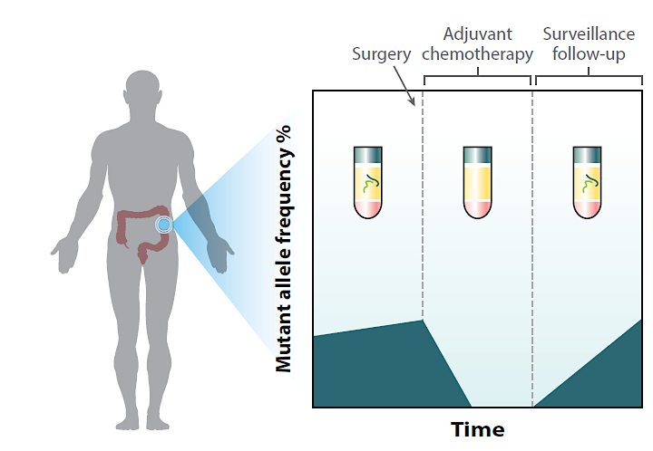
Defining Minimal Residual Disease (MRD)
ctDNA detection techniques
Tumor informed
Plasma only
MRD
negative
MRD
positive
Morris and Strickler, Annu Rev Med. 2021. 72:399–413.

Slide 43
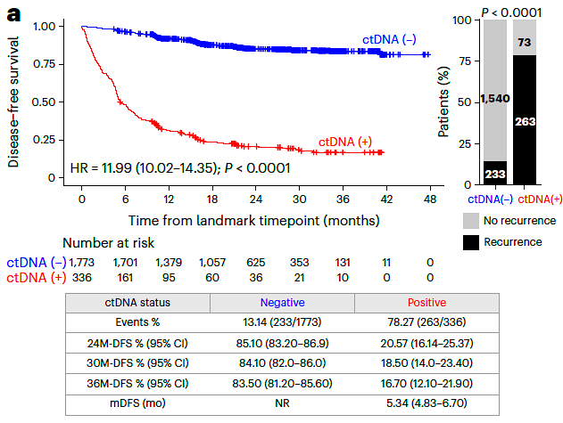
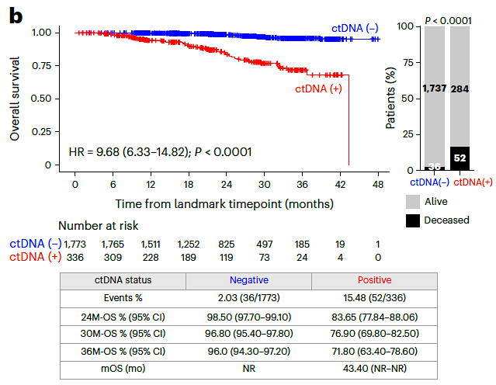
MRD status after surgery is strongly prognostic GALAXY Study: Tumor-informed MRD testing after resection in patients with stage II-IV CRC (n=2,109)
Disease-free survival
Overall survival
Nakamura et. al., Nature Medicine (2024) 30, 3272–3283

Slide 44
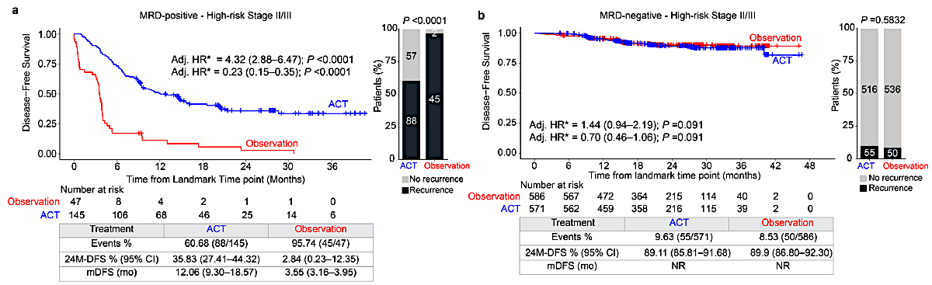
GALAXY: Adjuvant chemotherapy for high-risk stage II/III disease
High-risk stage II/III: MRD+
High-risk stage II/III : MRD-
Nakamura et. al., Nature Medicine (2024) 30, 3272–3283

Slide 45
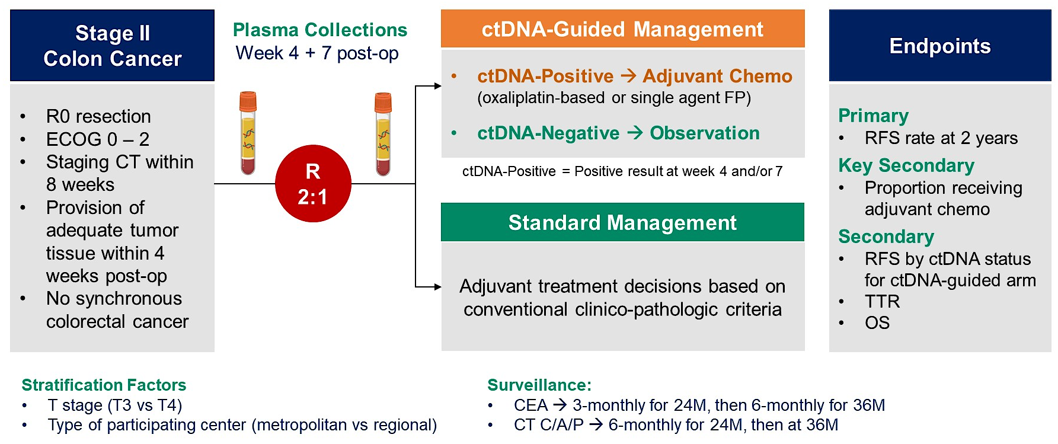
DYNAMIC Study Design
Tie et al., N Engl J Med 2022;386:2261-72.Presented at 2022 ASCO Annual Meeting

Slide 46
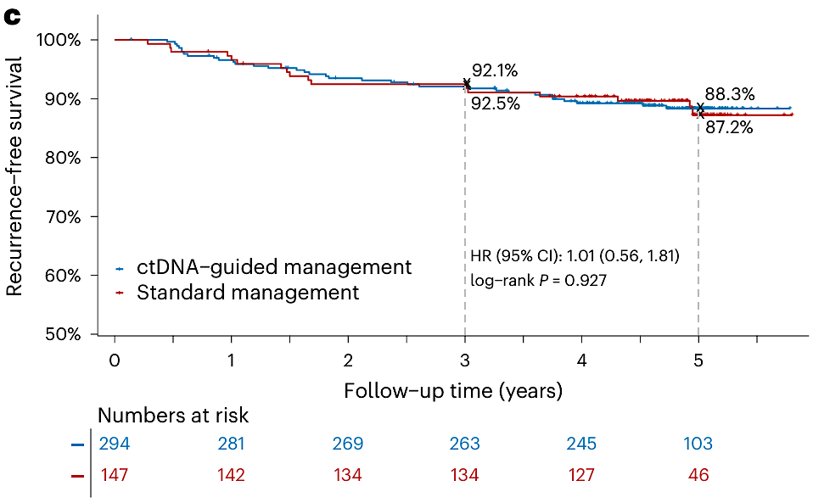
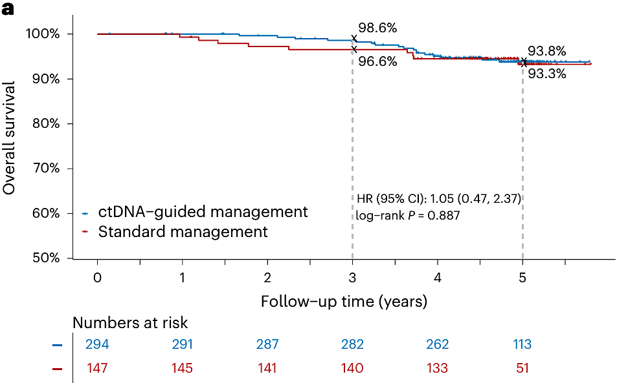
DYNAMIC: Updated 5-year RFS and Overall survival
Difference in 5-year RFS rate +1.1%
(95% CI for difference, -5.8 to 8.0%)
Median Follow-Up
ctDNA-Guided 59.7 months
SoC 59.7 months
(IQR 55.0-61.5)
Updated 5-Year RFS Analysis
Overall Survival
 | 5-Year OS Rate, % |  | CRC deaths, N | Non-CRC deaths, N
 | ctDNA (N = 294) | 93.8 | 7 | 10
 | SoC (N = 147) | 93.3 | 4 | 5
HR (95% CI): 1.05 (0.47, 2.37), p = 0.887
 | 5-Year RFS Rate, %
 | ctDNA | 88.3
 | SoC | 87.2
ctDNA-guided MRD-based adjuvant therapy significantly reduced the proportion of patients receiving postoperative adjuvant therapy compared to SOC based on conventional clinicopathological factors, while demonstrating non-inferiority in 5-year RFS/OS.
Tie J, et al. Nature Medicine 2025

Slide 47
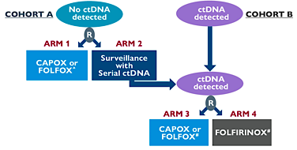
CIRCULATE-US (NRG-GI008)
Resected colon adenocarcinoma
Primary endpoints
Cohort A: ctDNA negative
Phase II: Time to ctDNA+
Phase III: DFS
Cohort B: ctDNA positive
Phase II/III: DFS
Study size: 1,750-1,912
COHORT A
Joint analysis with Circulate-Japan
COHORT B
*
Study PIs: Arvind Dasari (MDACC-NRG) and Christopher Lieu (UCCC-SWOG)
✴ Stage IIB, IIC, or any stage III colon cancer post-R0 resection
Arm 2 pts who become ctDNA +ve may cross-over to Cohort B
^ Duration and regimen per MD discretion
# Duration of therapy 6 mos.
Randomization in both arms 1:1
Stratification factors: 5FU vs cape, Stage (II/IIIA vs IIIB vs IIIC, Cohort A), Initial post-op ctDNA status (+ vs -, Cohort B).
Lieu et. al., J Clin Oncol 42, 2023 (3_suppl; TPS243). Presented at ASCO GI 2024

Slide 48
MRD monitoring for CRC: Key points
MRD testing is a validated prognostic tool
Observational data demonstrates no advantage for adjuvant chemo in patients with MRD negative stage II/III colon ca
For stage II colon ca, MRD could be considered a “tie-breaker” for adjuvant chemotherapy
MRD testing might have utility in patients who have resection of metastatic lesions
Prospective trials are ongoing to explore the clinical utility of escalation and de-escalation strategies

Slide 49
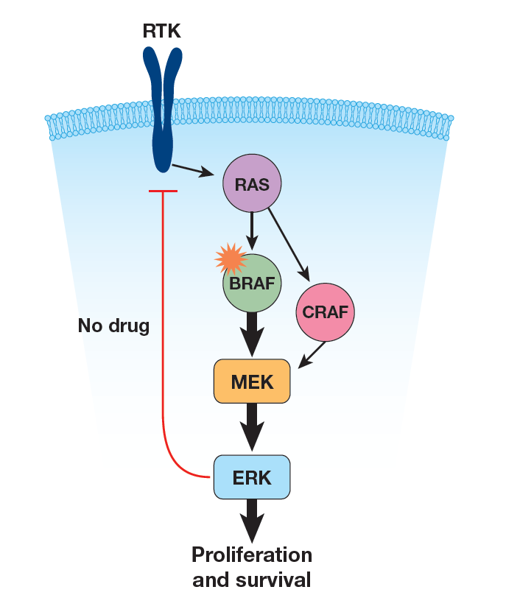
BRAF^{V600E} in metastatic CRC
~7% of CRC
Advanced age
More common in women
Right-sided
Poor prognosis
30% are MSI-H
Limited benefit from anti-EGFR Ab
For 2L+ mCRC, encorafenib + cetuximab is superior to SOC – FDA approved 4/2020
Strickler et al., Cancer Treat Rev.2017 Nov;60:109-119.

Slide 50
BREAKWATER: Study Design Phase 3, randomized, open-label, multicenter study for 1L treatment of BRAF V600E-mutant mCRC (NCT04607421)
Key eligibility criteria
Metastatic CRC
No previous chemotherapy
Measurable disease per RECIST
BRAFV600E by local or central testing
RAS WT and MSS
ECOG 0-1
Age: ≥ 16 years
Randomization 1:1:1
N= 637
Encorafenib + cetuximab + mFOLFOX6
(n=236)
SOC
(n=243)
Encorafenib + cetuximab
(n=158)
Stratification factors: Regions (US/Canada vs Europe vs ROW) and ECOG PS (0 vs 1)
Dual primary endpoints: PFS and ORR by BICR (EC+ mFOLFOX6 vs SOC)
Key secondary endpoint: Overall survival (EC + mFOLFOX6 vs SOC)
Kopetz et. al., Nat Med. 2025 Mar;31(3):901-908. Presented at ASCO GI 2025

Slide 51
BREAKWATER: 1L EC + mFOLFOX6 vs SOC
 | Encorafenib + Cetuximab + mFOLFOX6 (N= 236) | SOC (N= 243) | HR (95% CI) | P-valueª | Encorafenib + Cetuximab (N= 158)
ORR^{b} | 65.7% | 37.4% |  |  | 45.6%
PFS^{b}, months (95% CI) | 12.8 (11.2-15.9) | 7.1 (6.8-8.5) | 0.53 (0.407-0.677) | <0.0001 | 6.8 (5.7-8.3)
OS, months (95% CI) | 30.3 (21.7-NE) | 15.1 (13.7, 17.7) | 0.49 (0.375-0.632) | <0.0001 | 19.5 (17.6-22.5)
ª one-sided stratified log rank test ^{b} By BICR
Elez et. al., NEJM 2025 DOI: 10.1056/NEJMoa2501912
Presented at ASCO 2025

Slide 52
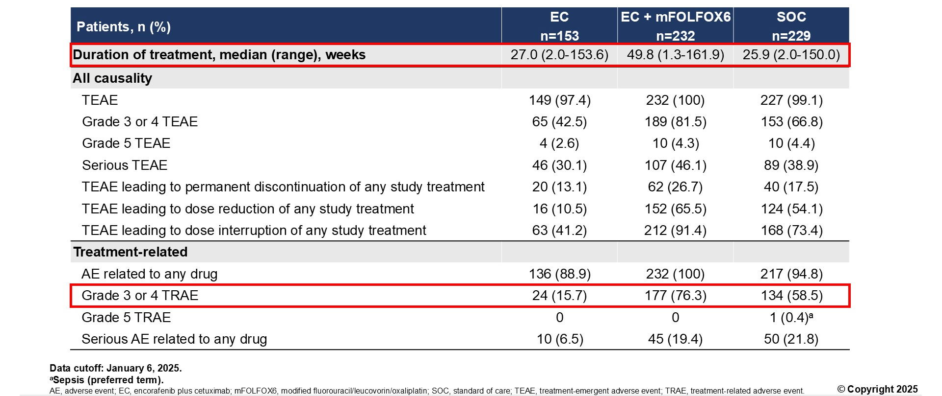
BREAKWATER: Safety Summary
Elez et. al., NEJM 2025 DOI: 10.1056/NEJMoa2501912
Elez et al. ASCO 2025;Abstract LBA3500

Slide 53
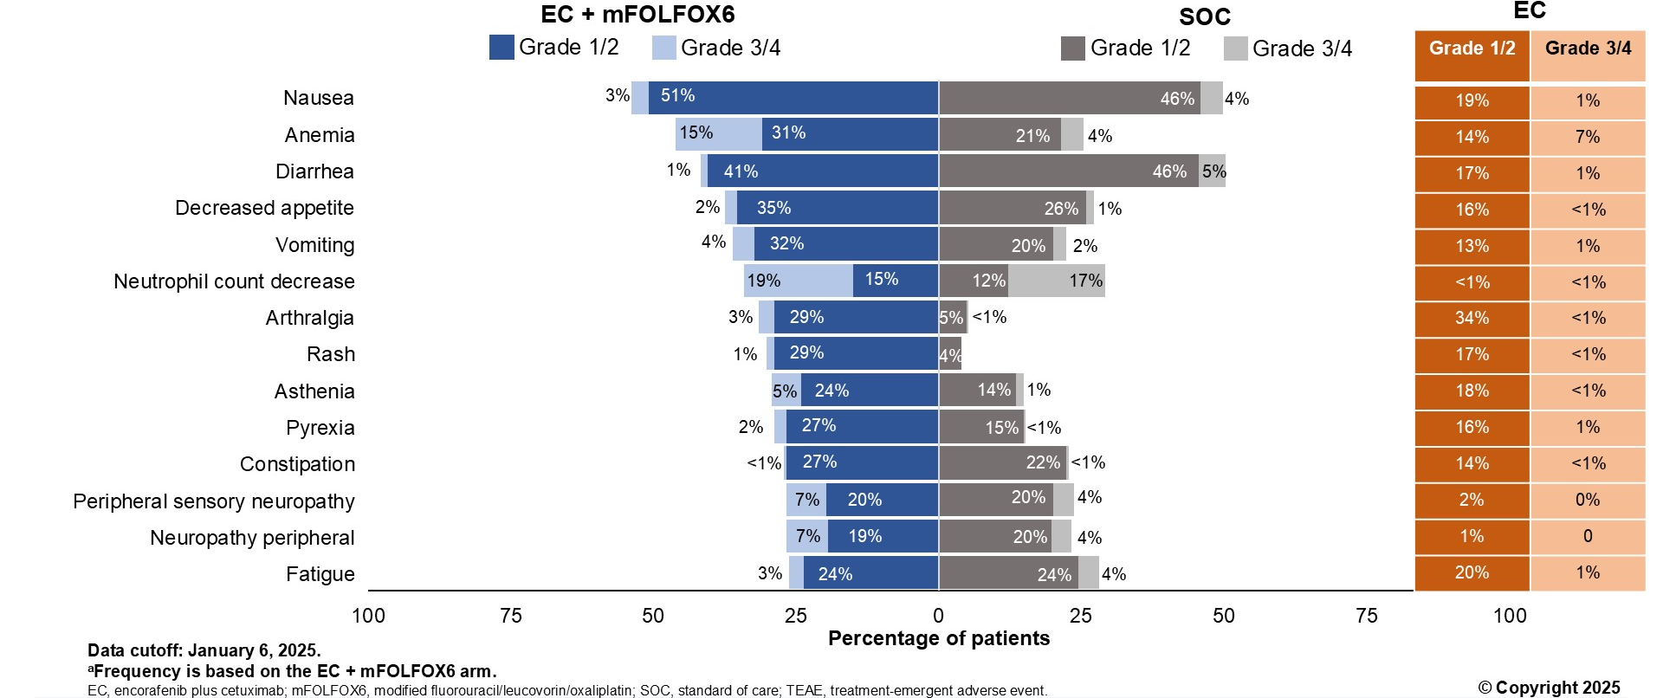
BREAKWATER: Most frequent all-causality TEAEs
Elez et. al., NEJM 2025 DOI: 10.1056/NEJMoa2501912
Elez et al. ASCO 2025;Abstract LBA3500

Slide 54
BRAF V600E: Key points
BRAF^{V600E} mutations are associated with poor prognosis and EGFR resistance
1L Encorafenib + cetuximab + FOLFOX is the new standard of care for newly diagnosed BRAF^{V600E} mutated metastatic CRC
Rapid biomarker testing at the time of diagnosis of metastatic disease is essential

Slide 55
KRAS G12C Inhibitors Have Modest Single-Agent Activity in KRAS G12C–Mutant mCRC
 | Adagrasib (n = 43)ª | Divarasib (n = 55) | Sotorasib (n = 62)
Objective response % (95% CI) per BICR | 23 (12-39) | 29 (18-43) | 10 (4-20)
Median duration of response, mo (95% CI) | 4.3 (2.3-8.3) | 7.1 (5.5-7.8) | 4.2 (2.9-8.5)
Median PFS, mo (95% CI) | 5.6 (4.1-8.3) | 5.6 (4.1-8.2) | 4 (2.8-4.2)
Median OS, mo (95% CI) | 19.8 (12.5-23.0) | Not reported | 10.6 (7.7-15.6)
AE leading to dose reduction, n (%) | 17 (39) | 41 (30)^{b} | 11 (18)^{c}
AE leading to discontinuation, n (%) | 0 (0) | 4 (3)^{b} | 1 (2)
ª 1 patient withdrew from study prior to first assessment. ^{b} Includes all solid tumors treated with divarasib. ^{c} Includes dose hold.
1. Yaeger R et al. N Engl J Med. 2023;388:44-54. 2. Sacher A et al. N Engl J Med. 2023;710-721. 3. Fakih MG et al. Lancet Oncol. 2022;23:115-124.

Slide 56
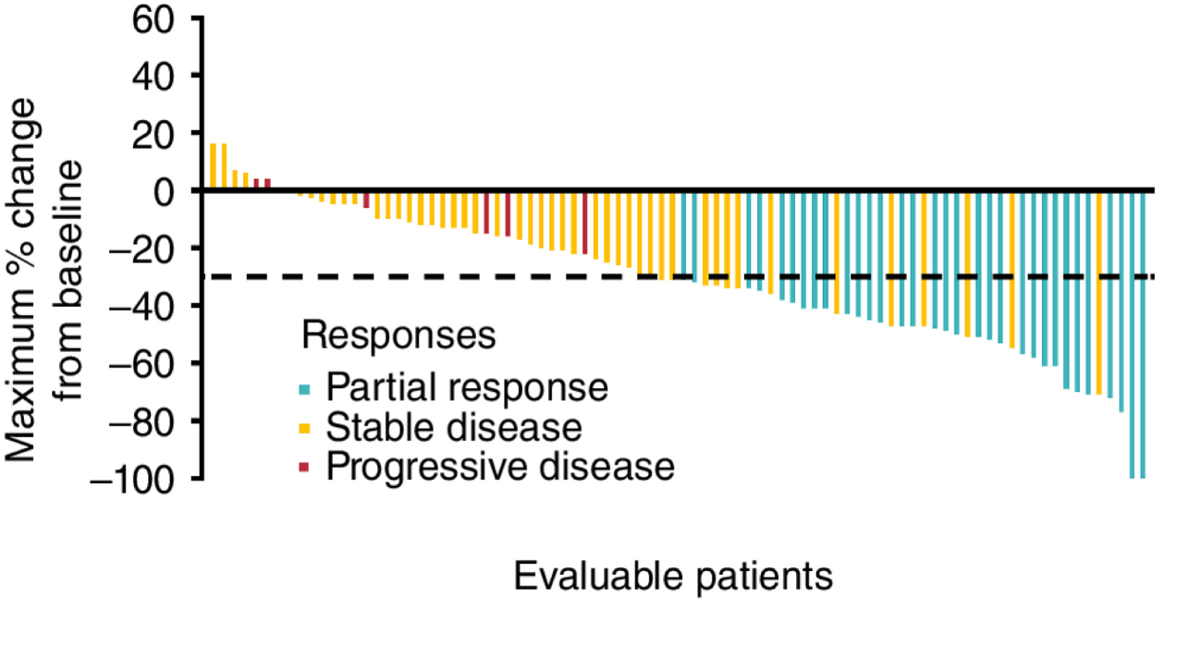
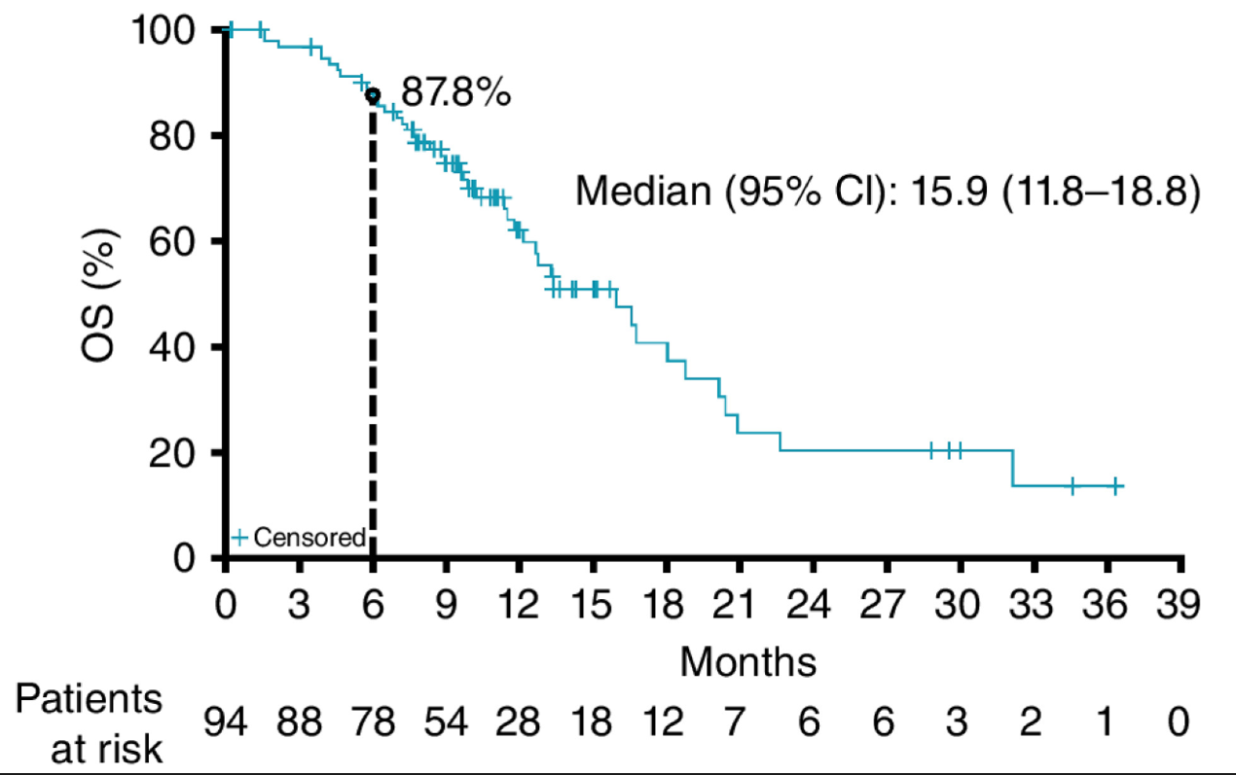
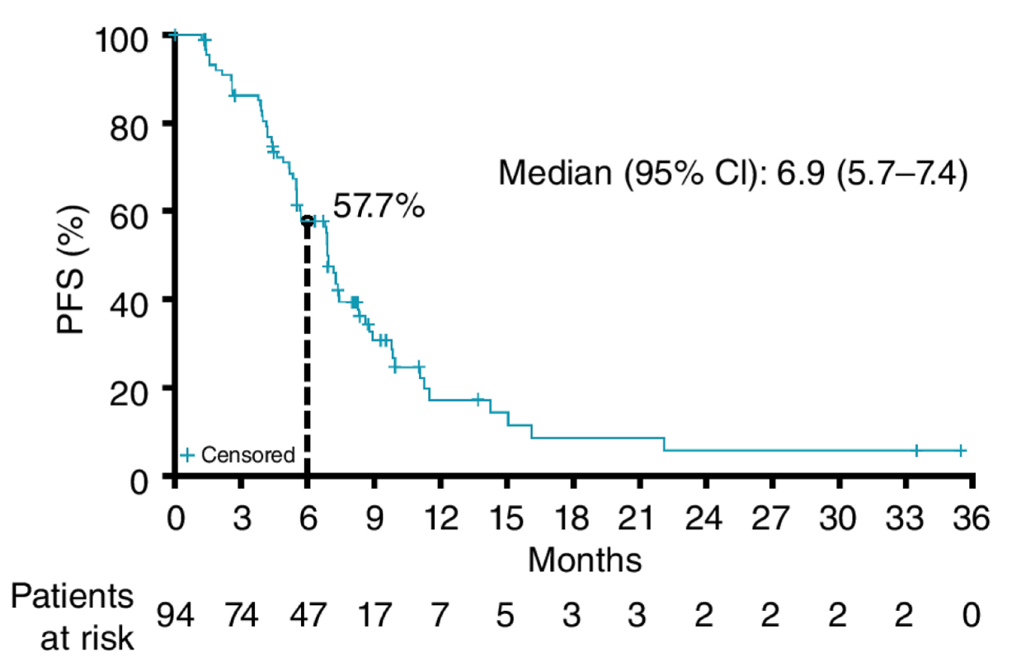
Adagrasib + cetuximab for KRAS G12C–Mutant mCRC
ORR= 34%
(95% CI, 25-45)
In June 2024, the FDA approved adagrasib + cetuximab for patients with KRAS G12C–mutated mCRC
Median OS= 15.9 months
(95% CI, 11.8-18.8)
Median PFS= 6.9 months
(95% CI, 5.7-7.4)
Yaeger et al. Cancer Discov. 2024;14:982-993.

Slide 57
Adagrasib + cetuximab for KRAS G12C–Mutant mCRC
Summary of TRAEs (N = 94)
TRAEs, n (%) | Any Grade | Grade 1 | Grade 2 | Grade 3 | Grade 4
Any TRAEs | 94 (100) | 8 (8.5) | 60 (63.8) | 22 (23.4) | 4 (4.3)
Most frequent TRAEs, n (%) Nausea Vomiting Diarrhea Dermatitis acneiform Fatigue Dry skin Hypomagnesemia Headaches Rash | 57 (60.6) 48 (51.1) 46 (48.9) 45 (47.9) 40 (42.6) 32 (34) 27 (28.7) 25 (26.6) 21 (22.3) | 35 (37.2) 30 (31.9) 31 (33) 28 (29.8) 23 (24.5) 24 (25.5) 17 (18.1) 14 (14.9) 11 (11.7) | 20 (21.3) 18 (19.1) 14 (14.9) 15 (16) 16 (170) 8 (8.5) 7 (7.4) 8 (8.5) 8 (8.5) | 2 (2.1) 0 1 (1.1) 2 (2.1) 1 (1.1) 0 2 (2.1) 3 (3.2) 2 (2.1) | 0 0 0 0 0 0 1 (1.1) 0 0
29% of patients had a dose reduction of adagrasib
No patients experienced a TRAE leading to discontinuation of adagrasib
Yaeger et al. Cancer Discov. 2024;14:982-993.

Slide 58
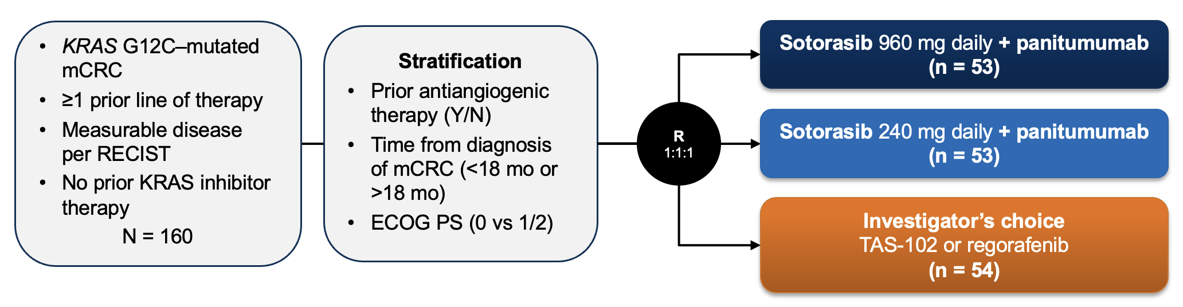
CodeBreaK300: Sotorasib + panitumumab for KRAS G12C–Mutant mCRC
 | Sotorasib 960 mg + PMAb (n = 53) | Sotorasib 240 mg + PMAb (n = 53) | Investigator’s Choice (n = 54)
Median PFS, mo HR (95% CI; P) | 5.6 0.49 (0.30-0.80; 0.006) | 3.9 0.58 (0.36-0.93; 0.03) | 2.2 (-;-)
ORR, % (95% CI per BICR) | 26 (15.3-40.3) | 6 (1.2-15.7) | 0 (0-6.6)
Disease control rate, % (95% CI per BICR) | 72 (57.7-83.2) | 68 (53.7-80.1) | 46 (32.6-60.4)
1. Pietrantonio F et al. ESMO 2023. 2. Fakih et al. N Engl J Med. 2023;389:2125-2139.

Slide 59
CodeBreaK300: Treatment discontinuation due to TRAEs was rare
 | Sotorasib 960 mg + Panitumumab (n = 53) | Sotorasib 240 mg + Panitumumab (n = 53) | Investigator’s Choice (n = 54)
Any AE, n (%) | 50 (94.3) | 51 (96.2) | 42 (82.4)
Grade ≥3 event, n (%) | 19 (35.8) | 16 (30.2) | 22 (43.1)
AE leading to sotorasib discontinuation, n (%) | 1 (1.9) | 1 (1.9) | –
Skin and subcutaneous tissue disorders, n (%) | 44 (83.0) | 45 (84.9) | 11 (21.6)
1. Pietrantonio F et al. ESMO 2023. 2. Fakih et al. N Engl J Med. 2023;389:2125-2139.

Slide 60
FOLFIRI + Sotorasib + Panitumumab: ORR and PFS by line of therapy
 | 1st Line N=40 | 2nd Line N= 13 | 3rd Line N= 12 | ≥ 4th Line N= 15
CodeBreaK 101 | Cohort F | Cohort G | Cohort G | Cohort G
ORR | 78% | 69% | 58% | 47%
PFS | Not reached | 8.3 mo | 7.1 mo | 8.4 mo
ORR was numerically higher for those with fewer lines of prior therapy
Responses were observed regardless of progression on prior irinotecan
Siena S et al. ESMO 2024;Abstract 505O
Strickler JH et al. ASCO 2025;Abstract 3506

Slide 61
Targeting KRAS: Key points
KRAS G12C inhibitors have limited single agent activity in mCRC – combinations with anti-EGFR Abs are required
Adagrasib + cetuximab and sotorasib + panitumumab are active and generally well tolerated – now FDA approved
Future therapeutic strategies for KRAS G12C may combine cytotoxic chemotherapy with targeted therapies

Slide 62
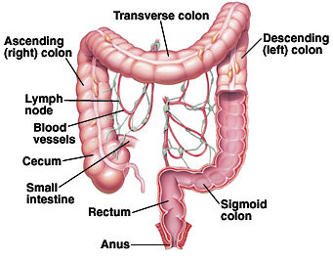
HER2 in Metastatic CRC
Usually left-sided
~ 3% of patients with metastatic CRC
Enriched in patients with RAS/ BRAF WT disease
Associated with lung, brain metastases
May drive resistance to EGFR antibodies

Slide 63
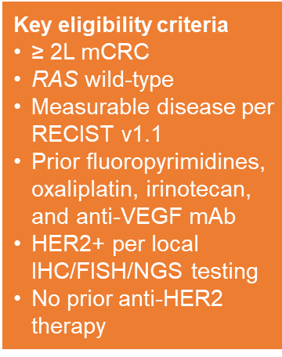
MOUNTAINEER: Tucatinib + Trastuzumab for HER2+ mCRC - Phase 2 Study Design
Primary endpoint:
Confirmed ORR in Cohorts A+B (RECIST v1.1 by BICR)
Secondary endpoints:
DOR in Cohorts A+B
PFS in Cohorts A+B
OS in Cohorts A+B
ORR by 12 weeks of treatment in Cohort C (RECIST 1.1 by BICR)
Cohort A
Tucatinib + Trastuzumab (n=45)
Cohort B
Tucatinib + Trastuzumab (n=41)
R (4:3)
Cohort C*
Tucatinib (n=31)
NCT03043313
*cross-over to Cohort B allowed in case of non-response or disease progression
Tucatinib is an oral, small molecule TKI that targets HER2
Highly selective for the HER2 receptor
Selectivity may improve tolerability (skin rash, diarrhea, etc.) compared to non-selective TKIs
Strickler JH et al. Lancet Oncol. 2023;24(5):496-508. Corti C et al. ESMO Open. 2021;6(2):100063. Moulder SL et al. Clin Cancer Res. 2017;23(14):3529-3536.

Slide 64
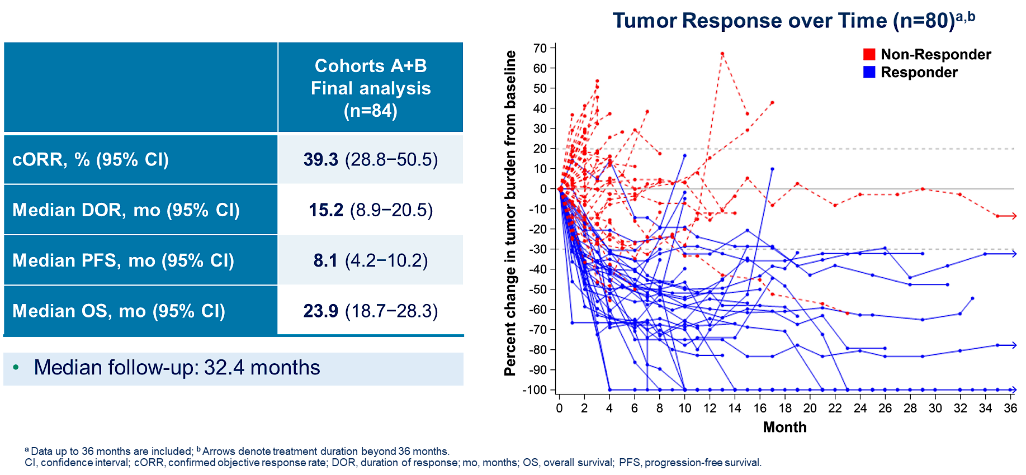
MOUNTAINEER: Efficacy outcomes for tucatinib + trastuzumab
Strickler JH et al. ASCO 2024;Abstract 3509

Slide 65
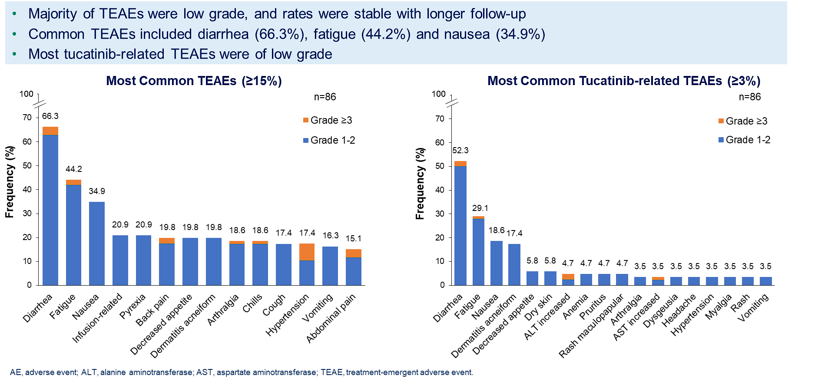
MOUNTAINEER: Tucatinib + trastuzumab AE profile
Strickler JH et al. ASCO 2024;Abstract 3509

Slide 66
DESTINY-CRC01: Trastuzumab deruxtecan (T-DXd) for HER2+ mCRC - Efficacy Outcomes
Cohort A, N=53 (response assessed by BICR)¹⁻³
Confirmed ORR, % (95% CI) | 45.3% (31.6-59.6)
mDOR, months (95% CI)² | 7.0 months (5.8-9.5)
Disease control rate, % (95% CI) | 83.0% (70.2-91.9)
PFS, months (95% CI)² | 6.9 months (4.1-8.7)
OS, months (95% CI)² | 15.5 months (8.8-20.8)
Data cutoff (Dec 28, 2020)
BICR = blinded independent central review; CI = confidence interval; HER2+ = HER2 gene amplification;
mCRC = metastatic colorectal cancer; NE = not evaluable; ORR = objective response rate; OS = overall survival; PFS = progression-free survival
Siena S et al. Lancet Oncol. 2021;22(6):779-789. Yoshino T et al. 2021 ASCO Annual Meeting; Abstract 3505. Yoshino T et al. Nat Commun. 2023;14(1):3332

Slide 67
DESTINY-CRC02: Trastuzumab deruxtecan for HER2+ mCRC - Efficacy Outcomes
5.4 mg/kg Q3W
(n = 82)
6.4 mg/kg Q3W
(n = 40)
Confirmed ORR, % (95% CI) | 37.8% (27.3-49.2) | 27.5% (14.6-43.9)
mDOR, months (95% CI) | 5.5 months (4.2-8.1) | 5.5 months (3.7-NE)
Disease control rate, % (95% CI) | 86.6% (77.3-93.1) | 85.0% (70.2-94.3)
PFS, months (95% CI) | 5.8 months (4.6-7.0) | 5.5 (4.2-7.0)
OS, months (95% CI) | 13.4 months (12.5-16.8) | NE (9.9-NE)
Raghav K et al. 2023 ASCO Annual Meeting; Abstract 3501.
Raghav et al., Lancet Oncol. 2024 Sep;25(9):1147-1162.

Slide 68
DESTINY-CRC02: Adjudicated Drug-Related ILD/ Pneumonitis by Independent Adjudication Committee
Adjudicated as drug-related ILD/pneumonitis, n (%) | T-DXd 5.4 mg/kg Q3W |  |  | T-DXd 6.4 mg/kg Q3W
 | Stage 1 n = 41ª | Stage 2 n = 42 | Total N = 83 | Stage 1 N = 39
Any grade | 4 (9.8) | 3 (7.1) | 7 (8.4) | 5 (12.8)
Grade 1 | 1 (2.4) | 0 | 1 (1.2) | 2 (5.1)
Grade 2 | 3 (7.3) | 3 (7.1) | 6 (7.2) | 2 (5.1)
Grade 3 | 0 | 0 | 0 | 0
Grade 4 | 0 | 0 | 0 | 0
Grade 5 | 0 | 0 | 0 | 1 (2.6)
Raghav K et al. 2023 ASCO Annual Meeting. Abstract 3501.
Raghav et al., Lancet Oncol. 2024 Sep;25(9):1147-1162.

Slide 69
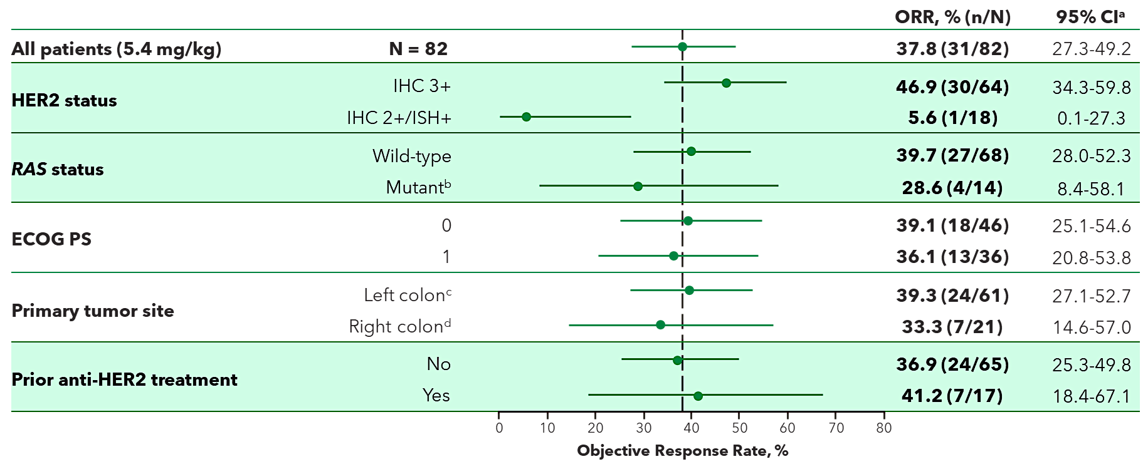
DESTINY-CRC-02: Trastuzumab deruxtecan for HER2+ mCRC - Best ORR (BICR) by T-DXd 5.4 mg/kg Subgroup
ªBased on the exact Clopper-Pearson method for binomial distribution. ^{b}All RASm responders were IHC 3+. ^{c}Includes rectum, sigmoid, and descending. ^{d}Includes cecum, ascending, and transverse.
Raghav K et al. 2023 ASCO Annual Meeting. Abstract 3501.
Raghav et al., Lancet Oncol. 2024 Sep;25(9):1147-1162.

Slide 70
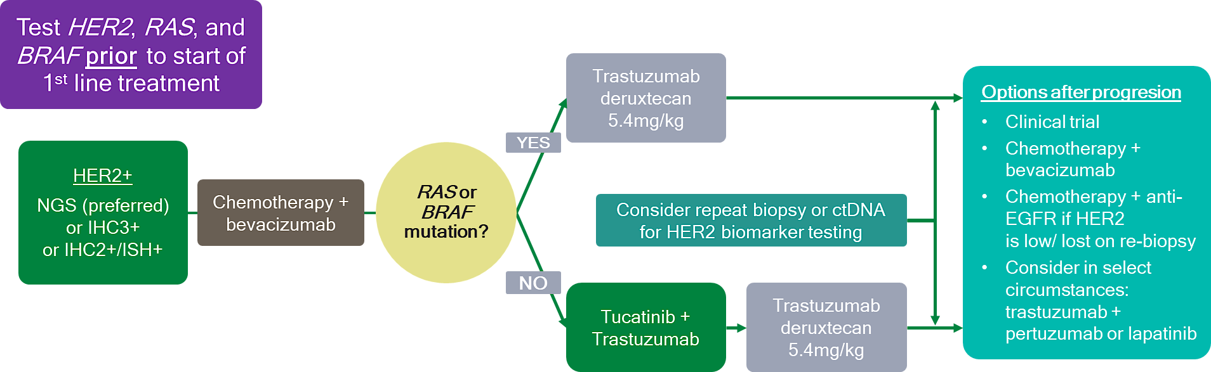
How I treat HER2+ metastatic CRC
Options after progression

Slide 71
Data + Perspectives: Clinical Investigators Explore the Application of Recent Datasets in Current Oncology Care CME/MOC, NCPD and ACPE Accredited
Saturday, October 11, 2025 7:15 AM – 12:30 PM ET

Slide 72
ctDNA-Guided Adjuvant Chemotherapy De-escalation in Stage III Colon Cancer: Primary Analysis of the ctDNA-Negative Cohort from the Randomized AGITG DYNAMIC-III Trial (Intergroup Study of AGITG and CCTG)
Tie J et al.
ESMO 2025;Abstract LBA9.
PRESIDENTIAL SYMPOSIUM III | MONDAY, OCTOBER 20 | 16:52 CEST

Slide 73
Circulating Tumour DNA (ctDNA) Clearance and Correlation with Outcome in the INTERCEPT Colorectal Cancer (CRC) Study
Osterlund O et al.
ESMO 2025;Abstract 732MO.
MINI ORAL| SUNDAY, OCTOBER 19 | 14:50 CEST

Slide 74
Questions from General Medical Oncologists
Do you prefer tumor-informed MRD assays versus tumor-naïve assays in early-stage CRC?
Is Signatera the best/only option for ctDNA monitoring?

Slide 75
Questions from General Medical Oncologists
Outside of a clinical trial, how do you utilize ctDNA monitoring in Stage II disease? Stage III disease?
What do you make of the results from the CALGB/SWOG 80702 trial, and are you considering celecoxib for any of your patients?

Slide 76
Questions from General Medical Oncologists
Can ctDNA be used for oligometastatic disease after definitive surgery and NED on scans?

Slide 77
Questions from General Medical Oncologists
How do you prevent and manage toxicities with the BREAKWATER regimen?
What do we know about BRAF inhibition in the adjuvant setting?
Is there any way to target BRAF non-V600E mutations?

Slide 78
Questions from General Medical Oncologists
Do I need to retest for HER2 on disease progression in mCRC?
T-DXd or tucatinib/trastuzumab first for HER2-positive mCRC?
Would you use T-DXd for HER2-low mCRC?

Slide 79
Questions from General Medical Oncologists
Do you prefer sotorasib or adagrasib?

