Slide 1
Data + Perspectives: Clinical Investigators Explore the Application of Recent Datasets in Current Oncology Care
CME/MOC, NCPD and ACPE Accredited
Saturday, October 11, 2025
7:15 AM – 12:30 PM ET

Slide 2
Agenda
Module 1 — Breast Cancer: Drs Burstein, Goetz, McArthur and Nanda
Module 2 — Prostate Cancer: Drs Antonarakis and M Smith
Module 3 — Colorectal Cancer: Drs Lieu and Strickler
Module 4 — Diffuse Large B-Cell Lymphoma and Follicular Lymphoma: Drs Lunning and S Smith

Slide 3


Prostate Cancer Faculty
Emmanuel S Antonarakis, MD
Clark Endowed Professor of Medicine
Division of Hematology, Oncology and
Transplantation
University of Minnesota
Minneapolis, Minnesota
Matthew R Smith, MD, PhD
Claire and John Bertucci Endowed Chair
in Genitourinary Cancers
Professor of Medicine
Harvard Medical School
Director, Genitourinary Malignancies Program
Massachusetts General Hospital Cancer Center
Boston, Massachusetts

Slide 4



Optimizing the Role of Hormonal Therapy in
in the Care of Patients with Prostate Cancer
Matthew R. Smith, M.D.,Ph.D.
Professor of Medicine, Harvard Medical School
Director, MGH Genitourinary Malignancies Program
Notes:
4

Slide 5
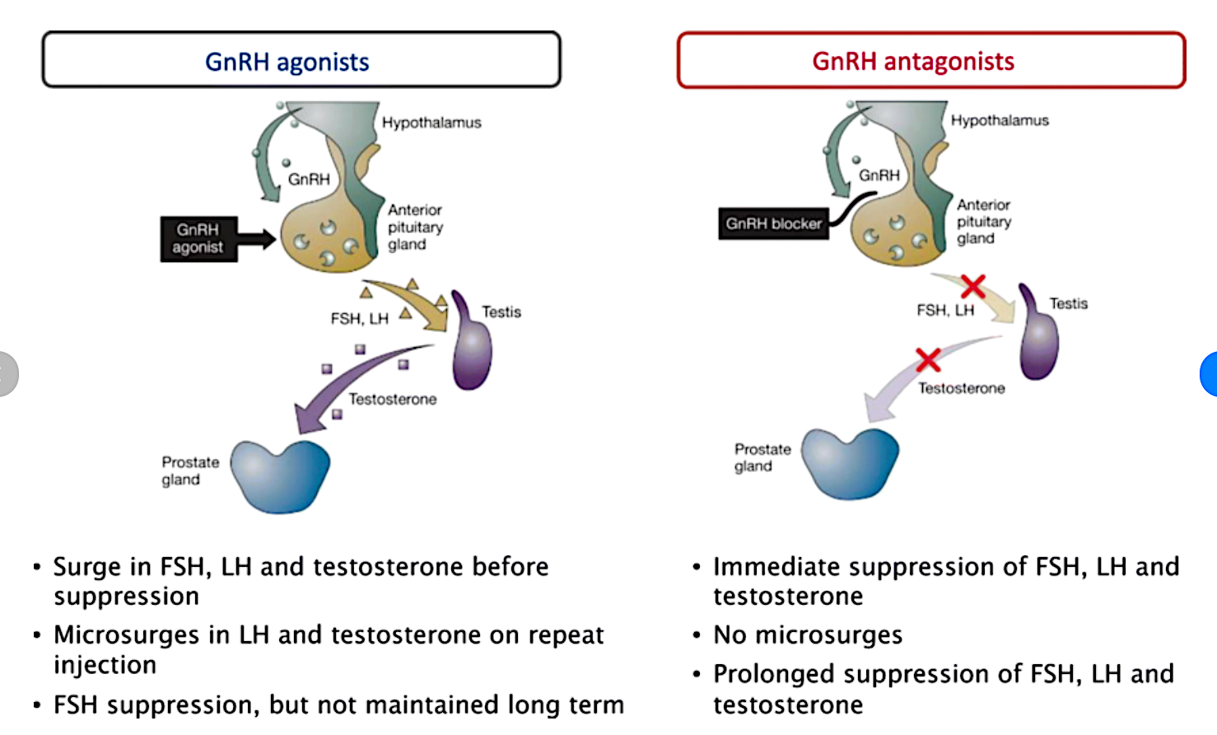
Melloni and Nelson (2020) Journal of Cardiovascular Translational Research 13(1):1-12.

Slide 6
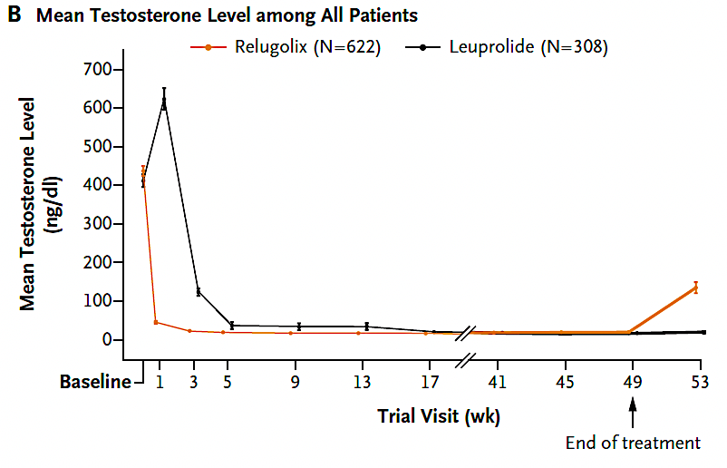
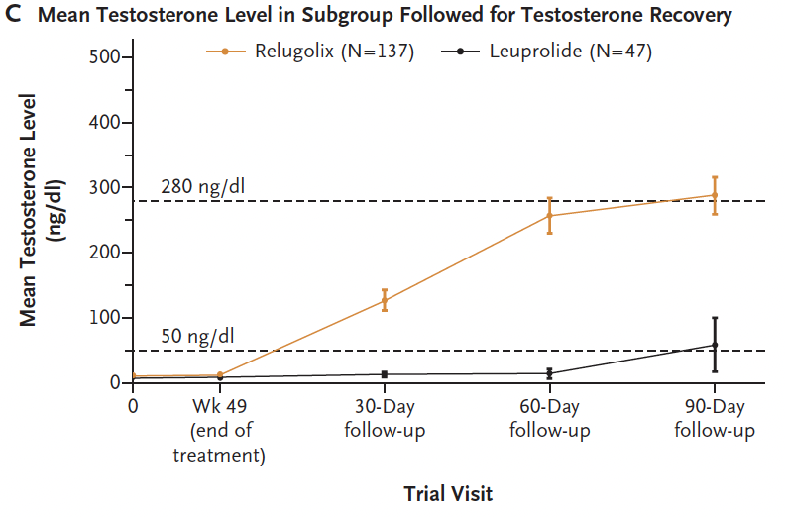
HERO: Randomized Controlled Trial of Leuprolide vs. Relugolix
Shore N et al. N Engl J Med 2020;382:2187-96.

Slide 7
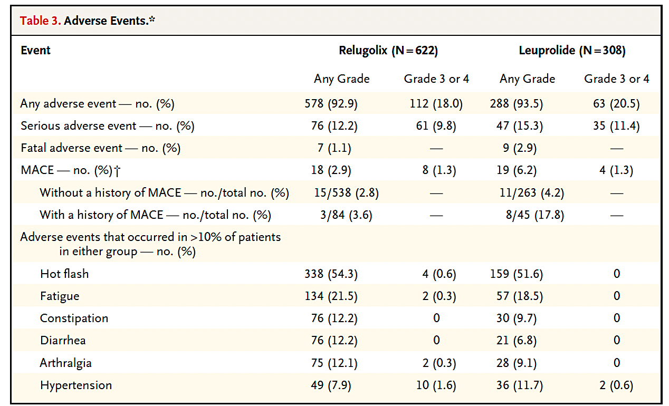
HERO: Randomized Controlled Trial of Leuprolide vs. Relugolix
Shore N et al. N Engl J Med 2020;382:2187-96.

Slide 8
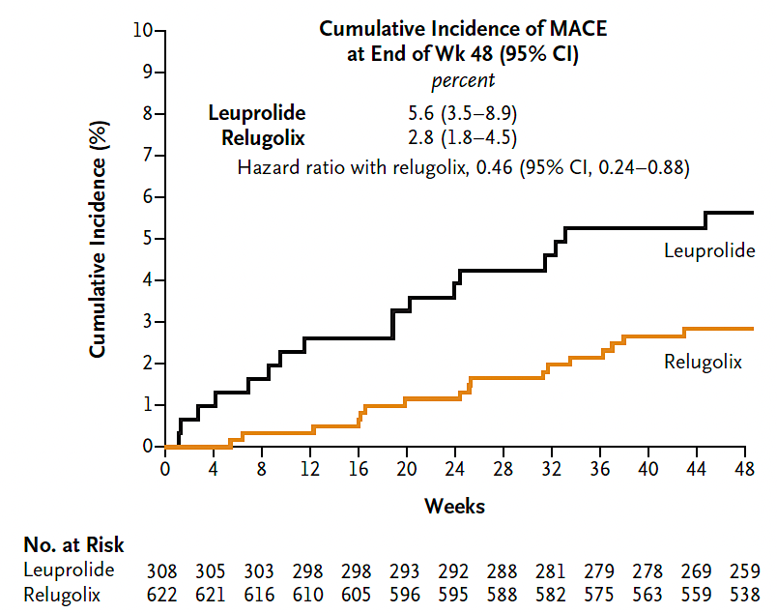
HERO: Randomized Controlled Trial of Leuprolide vs. Relugolix
Shore N et al. N Engl J Med 2020;382:2187-96.

Slide 9
Level 1 Evidence for Improved Overall Survival in mCSPC
Studies | Intervention | Control | Comments
GETUG-15 CHAARTED STAMPEDE-C | Docetaxel + ADT | ADT | Benefit in high-volume subgroup
LATITUDE STAMPEDE-G | Abiraterone + ADT | ADT | Similar benefits by risk group
ARCHES ENZAMET | Enzalutamide + ADT | ADT | Similar benefits by risk group
TITAN | Apalutamide + ADT | ADT | Similar benefits by risk group
ARASENS | Darolutamide + ADT + docetaxel | ADT + docetaxel | Similar benefits for recurrent and de novo metastatic disease
PEACE-1 | Abiraterone +ADT + docetaxel (+/- prostate radiation) | ADT + docetaxel (+/- prostate radiation) | Subgroup analysis
Parker et al Lancet 2018; Armstrong et al JCO 2021; Davis et al NEJM 2019; James N et al Lancet 2015; Sweeney et al NEJM 2015; Chi KN et al NEJM 2019; Fizazi K et al NEJM 2017; James et al NEJM 2017; Smith MR et al NEJM 2022; Fizazi K et al Lancet 2022

Slide 10
STAMPEDE: Docetaxel vs Abiraterone Comparison
SPARTAN ─ Overall Study Design
Phase 3 Placebo-Controlled, Randomized International Study
Overall Survival
Sydes et al (2018) Annals of Oncology 29:1235-1248

Slide 11
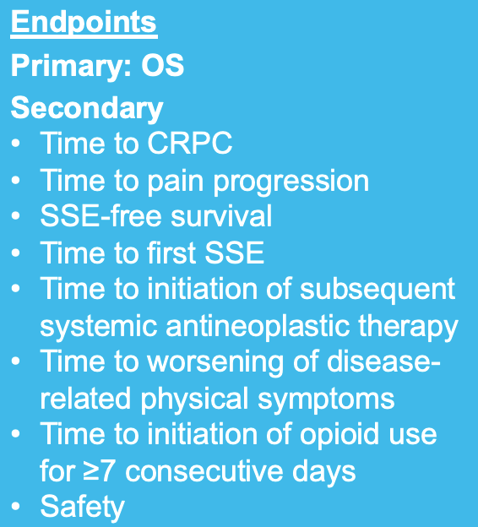
11
ARASENS Study Design
Global, randomized, double-blind, placebo-controlled phase III study (NCT02799602)
Docetaxel × 6
Endpoints
Primary: OS
Secondary
Time to CRPC
Time to pain progression
SSE-free survival
Time to first SSE
Time to initiation of subsequent systemic antineoplastic therapy
Time to worsening of disease-related physical symptoms
Time to initiation of opioid use for ≥7 consecutive days
Safety
Patients (N=1306)
mHSPC
ECOG PS 0 or 1
Candidates for ADT and docetaxel
Stratification
Extent of disease: M1a vs M1b vs M1c
ALP < vs ≥ ULN
Darolutamide 600 mg twice daily + ADT
1:1
randomization
(N=1305*)
Primary analysis
Placebo twice daily + ADT
Docetaxel × 6
FPFV: Nov 2016
LPFV: June 2018
Data cut-off
Oct 25, 2021
The primary analysis was planned to occur after ~509 deaths
Secondary efficacy endpoints were tested hierarchically
*One enrolled patient was excluded from all analysis sets because of Good Clinical Practice violations. ALP, alkaline phosphatase; CRPC, castration-resistant prostate cancer; ECOG PS, Eastern Cooperative Oncology Group performance status; FPFV, first patient first visit; LPFV, last patient first visit; M1a, nonregional lymph node metastases only; M1b, bone metastases ± lymph node metastases; M1c, visceral metastases ± lymph node or bone metastases; Q3W, every 3 weeks; SSE, symptomatic skeletal event; ULN, upper limit of normal.
Smith et al (2022) N Engl J Med DOI: 10.1056/NEJMoa2119115

Slide 12
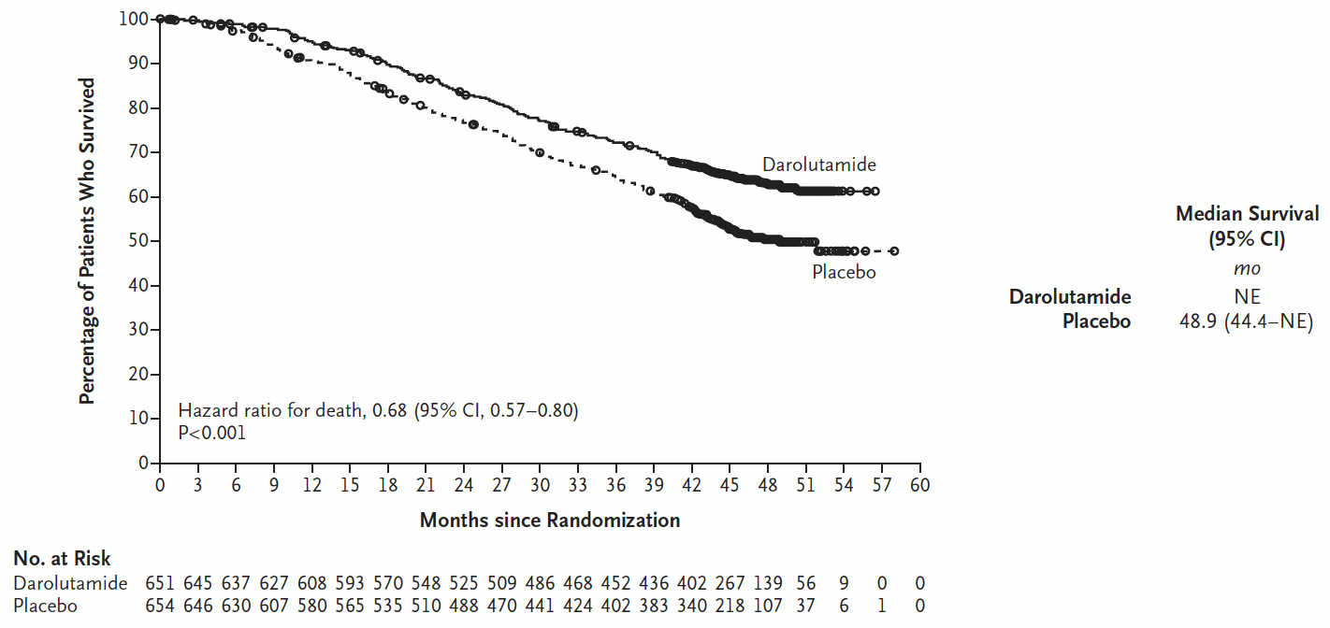
ARASENS Primary Endpoint: Overall Survival
Smith et al (2022) N Engl J Med DOI: 10.1056/NEJMoa2119115

Slide 13
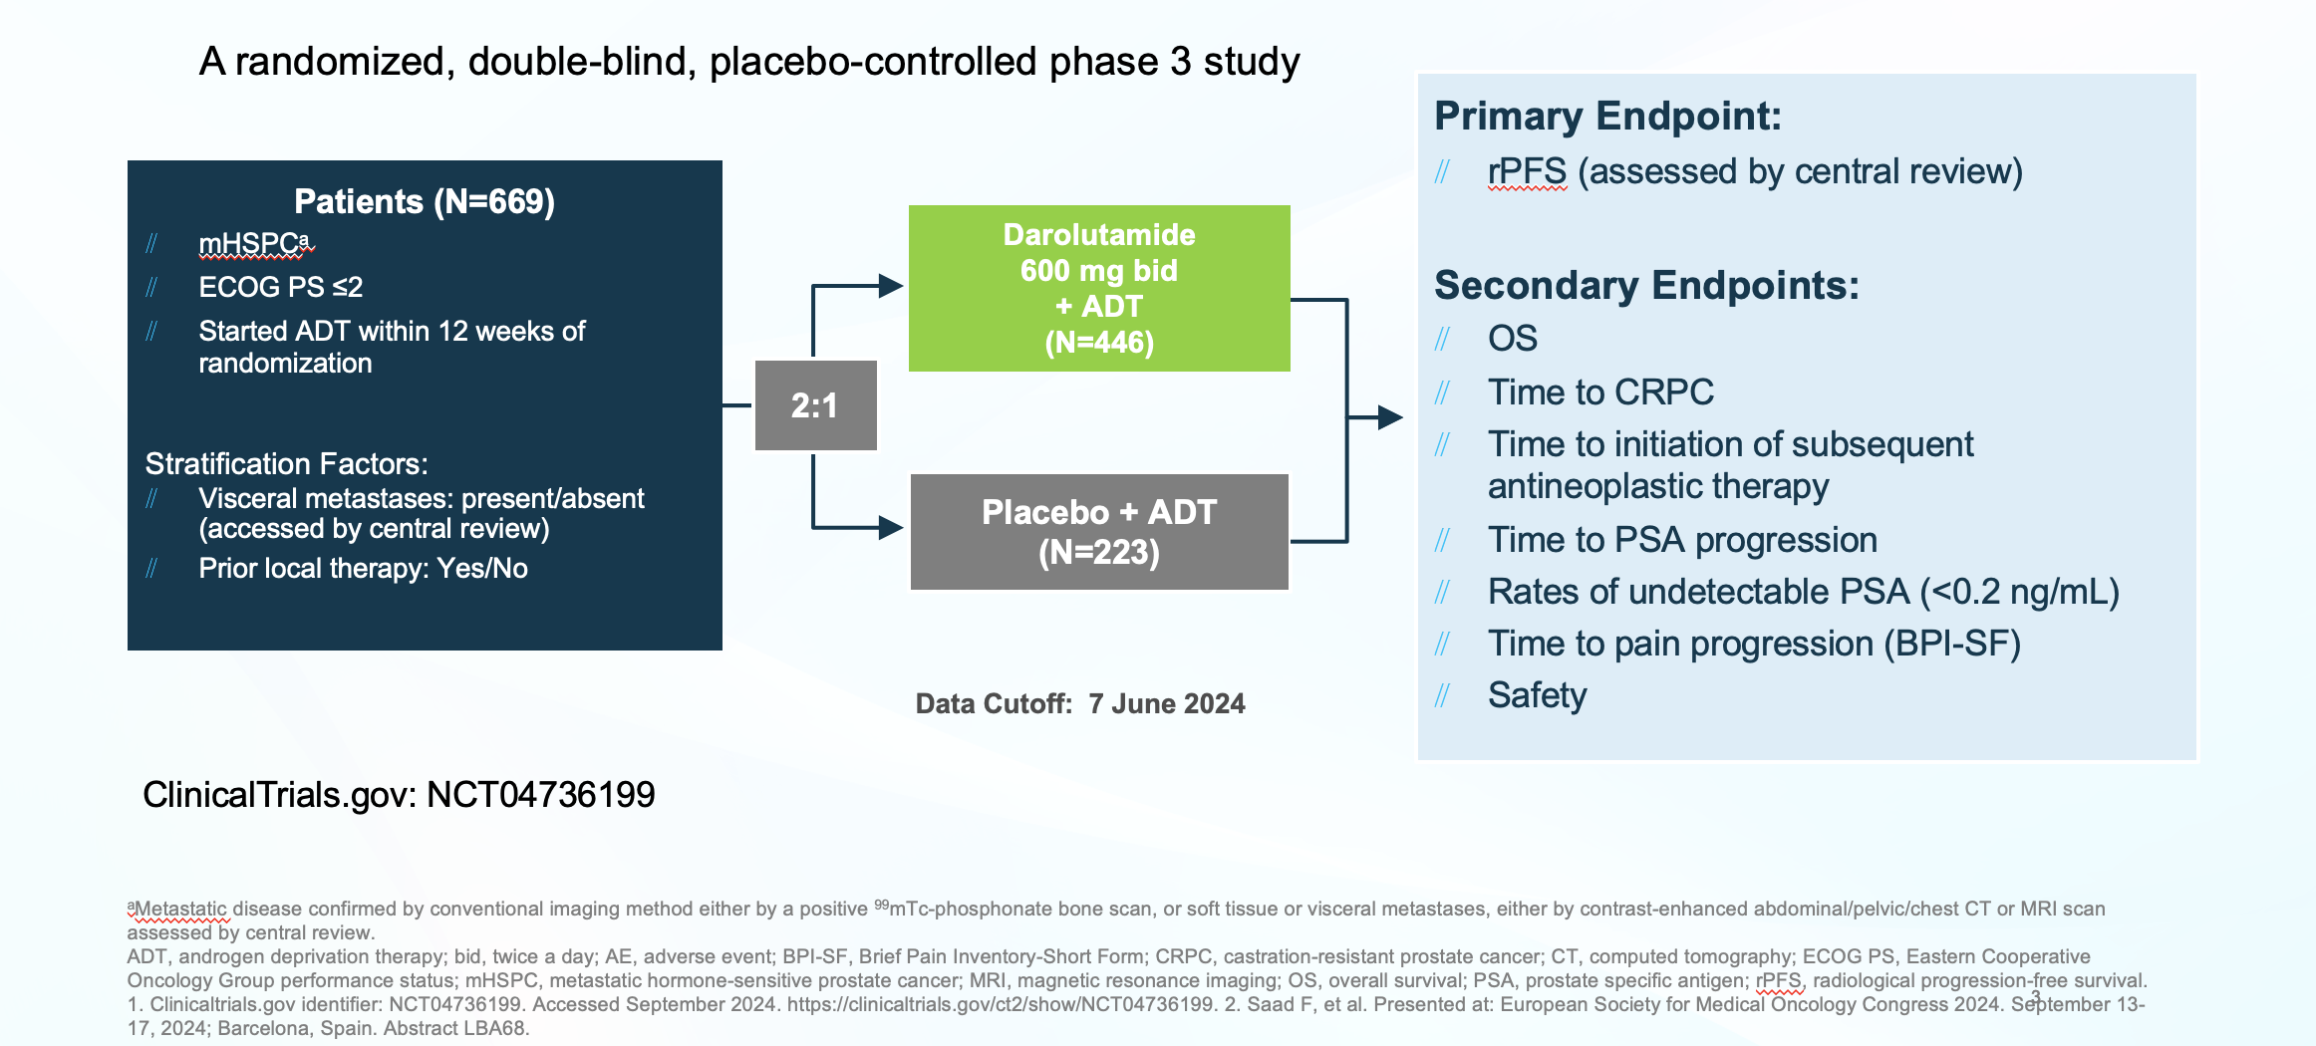
ARANOTE Study Design
Saad et al (2024) J Clin Oncol 42(36): 4271-4275

Slide 14
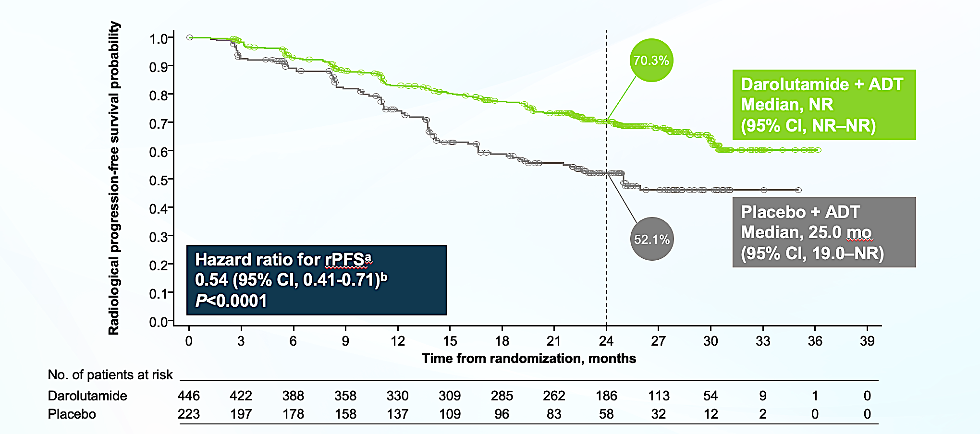
ARANOTE Primary Endpoint: rPFS
Saad et al (2024) J Clin Oncol 42(36): 4271-4275

Slide 15
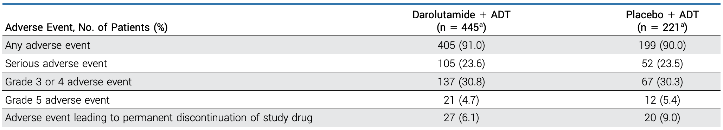
ARANOTE: Safety
Saad et al (2024) J Clin Oncol 42(36): 4271-4275

Slide 16
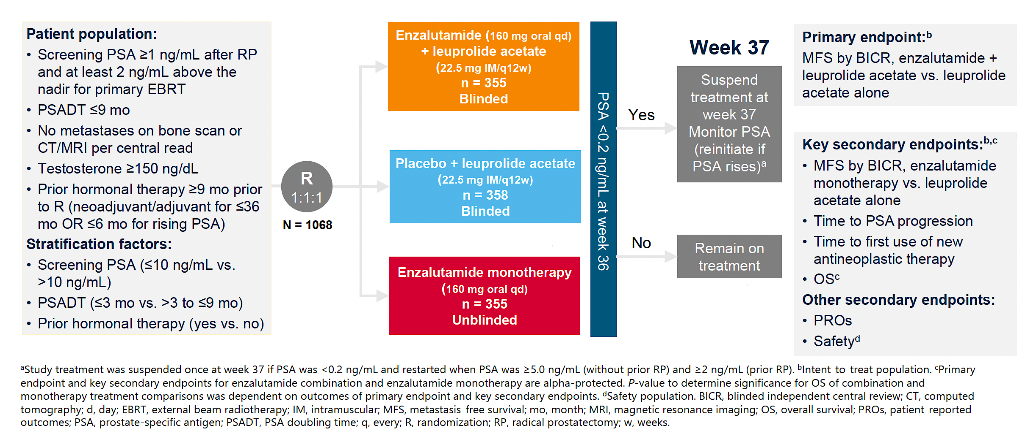
EMBARK Study Design
Freedland et al (2023) N Engl J Med 2023;389:1453-1465

Slide 17
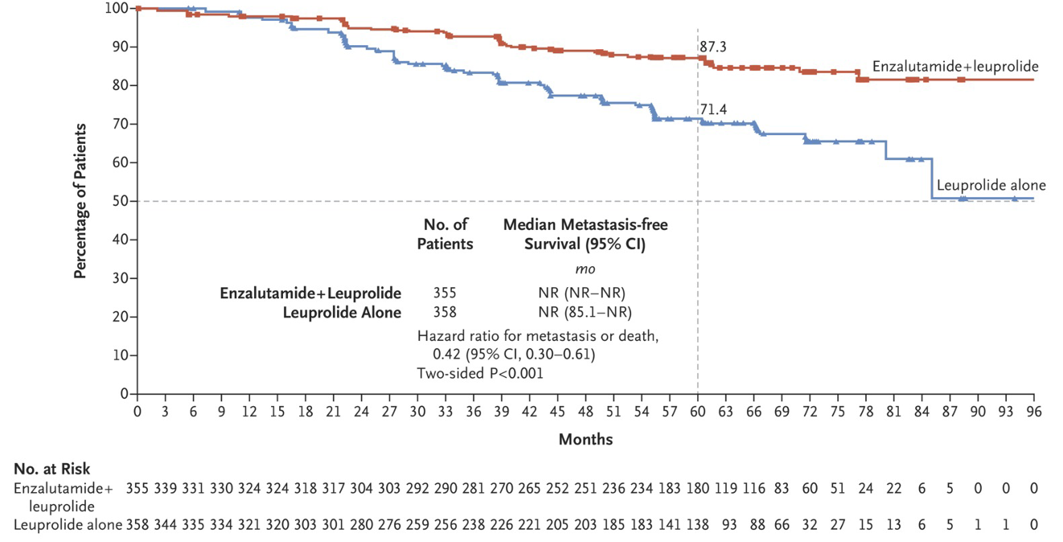
EMBARK Primary Endpoint:
MFS for Enzalutamide Combination vs. Leuprolide
Freedland et al (2023) N Engl J Med 2023;389:1453-1465

Slide 18
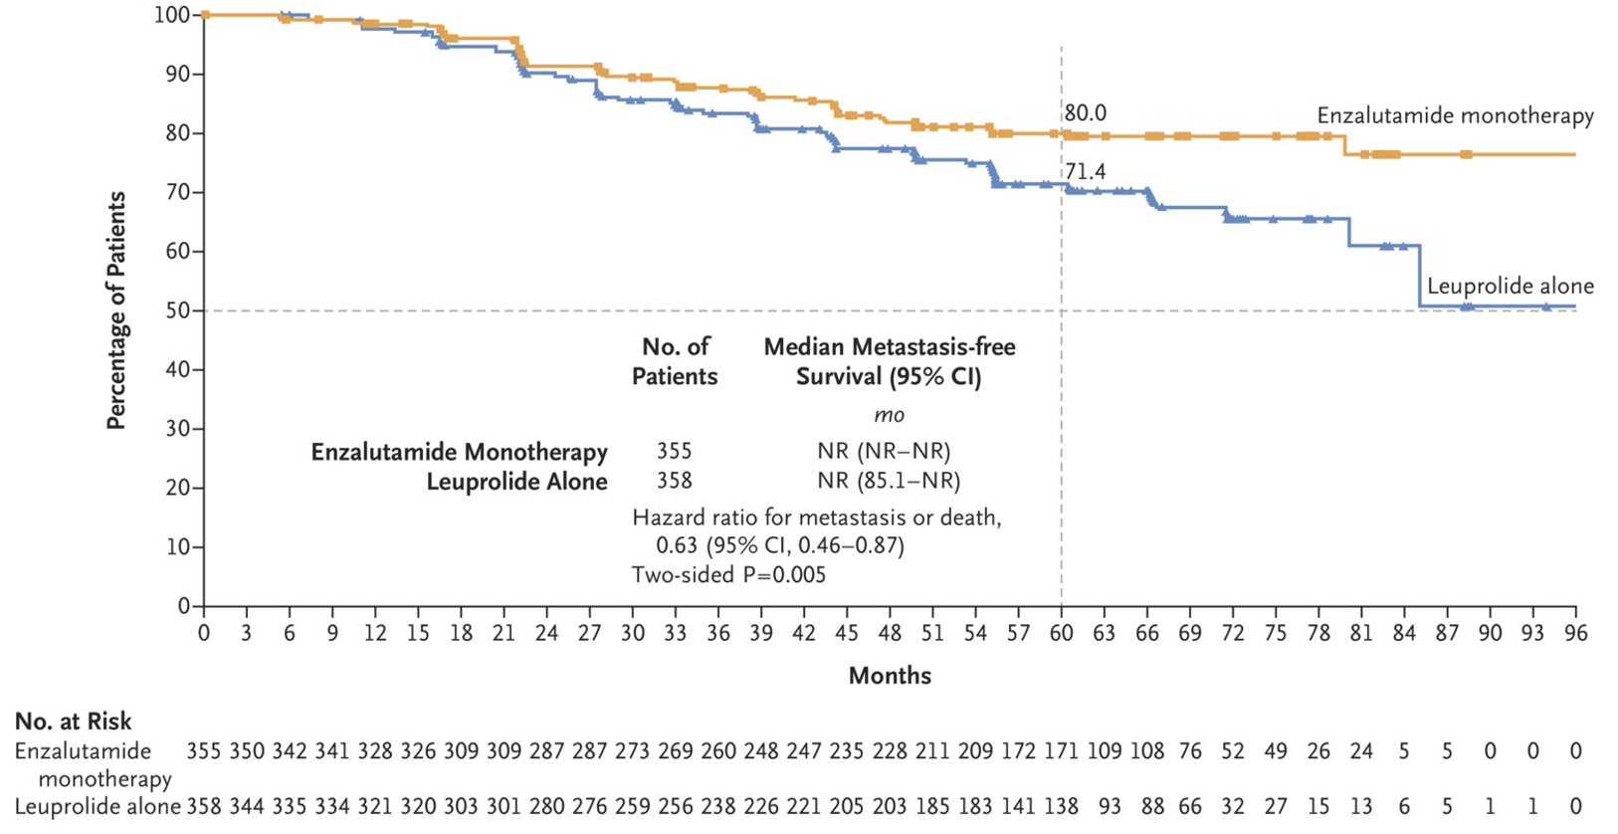
EMBARK Key Secondary Endpoint:
MFS for Enzalutamide Monotherapy vs. Leuprolide
Freedland et al (2023) N Engl J Med 2023;389:1453-1465

Slide 19
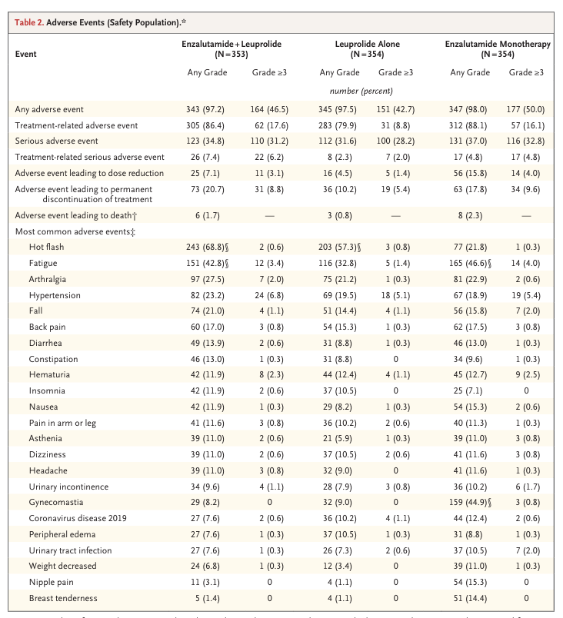
EMBARK: Safety
Freedland et al (2023) N Engl J Med 2023;389:1453-1465

Slide 20
EMBARK Phase 3 Study of Enzalutamide Plus Leuprolide
in Non-Metastatic CSPC
July 10, 2025 Press Release:
For patients treated with enzalutamide plus leuprolide versus placebo plus leuprolide, EMBARK met the key secondary endpoint with a statistically significant and clinically meaningful improvement in OS. Results also showed a favorable trend towards improved OS for patients treated with enzalutamide monotherapy versus placebo plus leuprolide, however the difference did not reach statistical significance.
https://www.pfizer.com/news/press-release/press-release-detail/xtandir-plus-leuprolide-significantly-improves-survival

Slide 21
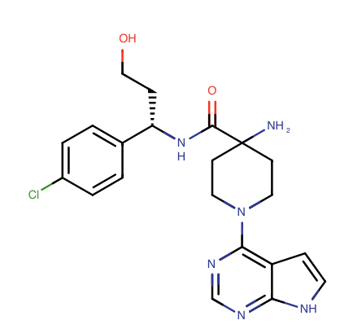
Capivasertib
Oral AKT inhibitor
Approved by the FDA in combination with fulvestrant for the treatment of adult patients with HR-positive, HER2-negative locally advanced or metastatic breast cancer with one or more alterations in PIK3CA/AKT1/PTEN gene(s).¹
This approval is based on favorable results obtained from the CAPItello-291 trial, in which the combination of capivasertib and fulvestrant reduced the risk of disease progression or death by 50% compared to fulvestrant alone.²
¹www.fda.gov/drugs/resources-information-approved-drugs/fda-approves-capivasertib-fulvestrant-breast-cancer.
²Turner et al (2023) N Engl J Med 388: 2025-2070

Slide 22
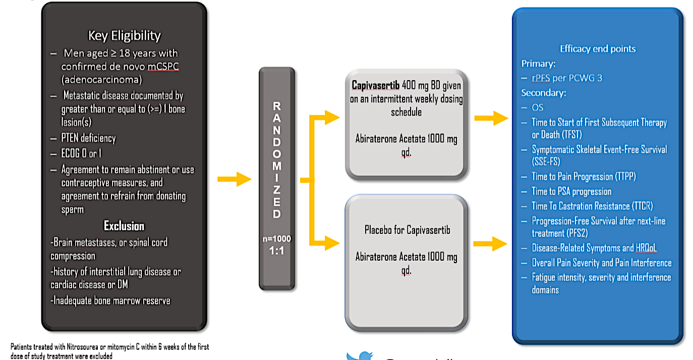
CAPItello-281 Phase 3 Study of Capivasertib in mCSPC
https://clinicaltrials.gov/study/NCT04493853

Slide 23
CAPItello-281 Phase 3 Study of Capivasertib in mCSPC
November 25, 2024 Press Release:
“Capivasertib combination in PTEN-deficient metastatic hormone-sensitive prostate cancer demonstrated statistically significant and clinically meaningful improvement in radiographic progression-free survival in CAPItello-281 Phase III trial.
The safety profile of capivasertib in combination with abiraterone and ADT in CAPItello-281 was broadly consistent with the known profile of each medicine.”
https://www.astrazeneca.com/media-centre/press-releases/2024/truqap-improved-rpfs-in-advanced-prostate-cancer.html

Slide 24
Conclusions
AR pathway inhibitors (ARPIs) have an important role across a broad range of prostate cancer disease states:
Abiraterone and enzalutamide improve rPFS and OS in mCRPC, either before or after chemotherapy
Apalutamide, enzalutamide and darolutamide improve MFS and OS in nmCRPC
Abiraterone, apalutamide, enzalutamide and darolutamide improve OS in mCSPC
Abiraterone improves MFS and OS in high-risk primary and recurrent nmCSPC
Enzalutamide improves MFS in recurrent nmCSPC

Slide 25
Data + Perspectives: Clinical Investigators Explore the Application of Recent Datasets in Current Oncology Care
CME/MOC, NCPD and ACPE Accredited
Saturday, October 11, 2025
7:15 AM – 12:30 PM ET

Slide 26
EMBARK: Overall Survival with Enzalutamide in Biochemically Recurrent Prostate Cancer
Freedland S et al.
ESMO 2025;Abstract LBA47.
PROFFERED PAPER | SUNDAY, OCTOBER 19 | 10:52 CEST

Slide 27
A Phase III Study of Capivasertib (capi) + Abiraterone (abi) vs Placebo (pbo) + abi in Patients (pts) with PTEN Deficient de novo Metastatic Hormone-Sensitive Prostate Cancer (mHSPC): CAPItello-281
Fizazi K et al.
ESMO 2025;Abstract 2383O.
PROFFERED PAPER | SUNDAY, OCTOBER 19 | 11:19 CEST

Slide 28
Questions from General Medical Oncologists
In what situations, if any, do you use intermittent endocrine treatment, and what is your protocol?

Slide 29
Questions from General Medical Oncologists
When do you use relugolix versus degarelix?
Do you prefer relugolix for patients with cardiovascular risk factors?
72-year-old man with high-volume mHSPC, history of atrial fibrillation and prior NSTEMI: Would you use relugolix, and how do you weigh adherence with daily oral dosing?
Can relugolix be used with enzalutamide in the nonmetastatic setting? What advantages might this provide?

Slide 30
Questions from General Medical Oncologists
In what situations, if any, do you use enzalutamide monotherapy? What preemptive breast protection strategies do you use, if any?

Slide 31
Questions from General Medical Oncologists
How do you select which AR pathway inhibitor to combine with ADT for mHSPC?

Slide 32
Questions from General Medical Oncologists
In what situations do you use docetaxel in addition to an AR pathway inhibitor for mHSPC?
Can I start with a doublet and then add chemotherapy later if the patient fails to respond?
When can I give a treatment holiday to patients who have mHSPC with good response and an undetectable PSA?

Slide 33
Questions from General Medical Oncologists
A 63-year-old man with de novo mHSPC has PTEN loss on NGS. Where will capivasertib fit in, and do you see urologists prescribing it?
What is the best way to assess PTEN status in prostate cancer? Should community-based oncologists be ordering PTEN testing at the current time? If so, when in the treatment sequence?
Is the tolerability profile with capivasertib in prostate cancer any different than it is in breast cancer? Does it exacerbate any of the side effects associated with AR pathway inhibitors and/or ADT when these drugs are used in combination?
How much of a concern is hyperglycemia when capivasertib is combined with abiraterone/ADT?

Slide 34
Available and Emerging Therapeutic Approaches for Metastatic CRPC
Research To Practice
October 11, 2025
Emmanuel S. Antonarakis, M.D.
Clark Endowed Professor of Medicine
Division of Hematology/Oncology & Transplantation, University of Minnesota
Associate Director of Translation, Masonic Cancer Center

Slide 35
PARP inhibitors for HRR_{m} and BRCA1/2_{m} advanced prostate cancer

Slide 36
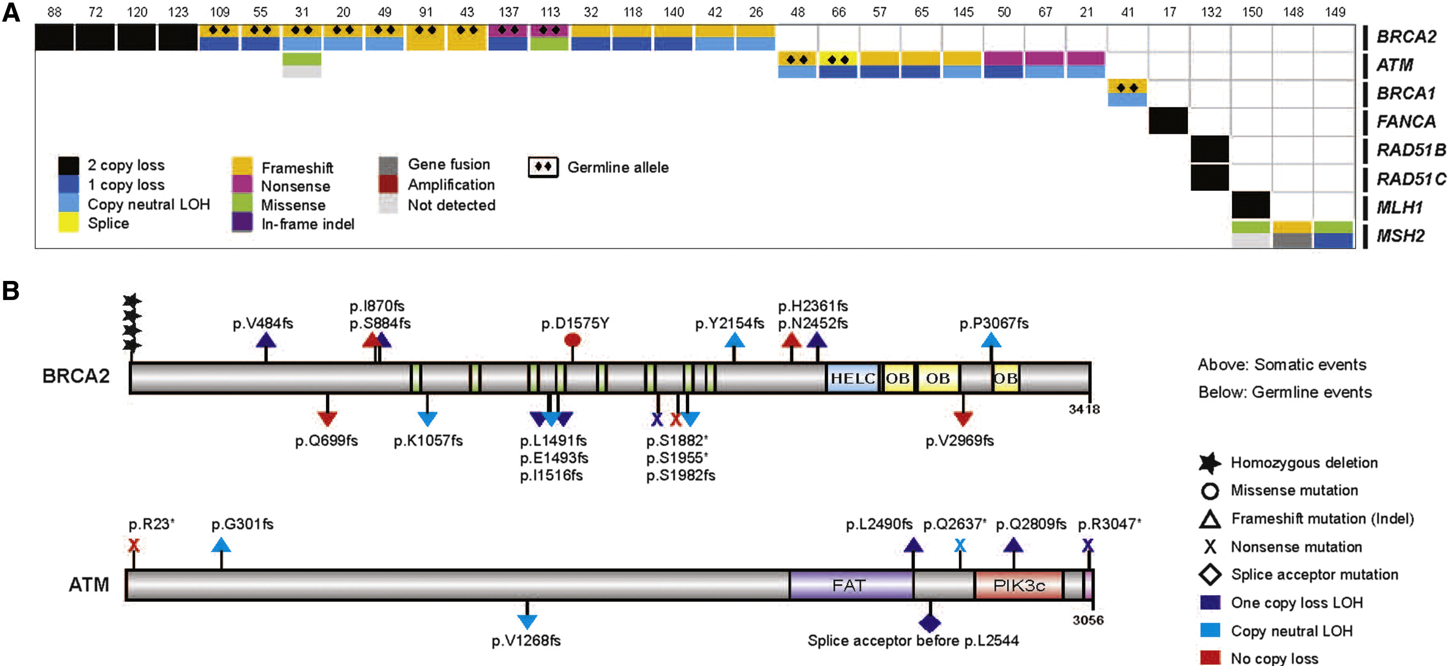
HRR Genes and Metastatic Prostate Cancer

Slide 37
Most relevant HRR_{m} for PARPi efficacy?
“First Tier” | “Second Tier” | “Third Tier”
BRCA2 (6–8%) | CDK12 (5–7%) | ATM (5–7%)
BRCA1 (1–2%) | BARD1 (1%) | CHEK2 (2–3%)
PALB2 (1–2%) | BRIP1 (1–2%) | CHEK1 (1%)
RAD51B (1%) | RAD51C (1%) | FANCL (1–2%)
RAD54L (1%) | RAD51D (1%)

Slide 38
mCRPC ARPI + PARPi: PROpel, MAGNITUDE, TALAPRO-2
BRCA1, BRCA2
BRCA1/2, PALB2, ATM, ATR, CHEK2, FANCA, CDK12, NBN, RAD51C, MRE11

Slide 39
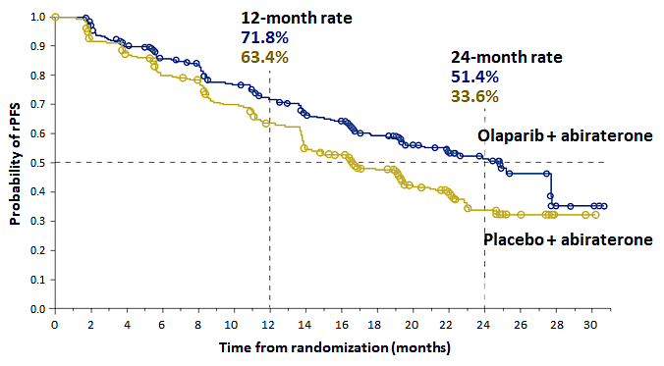
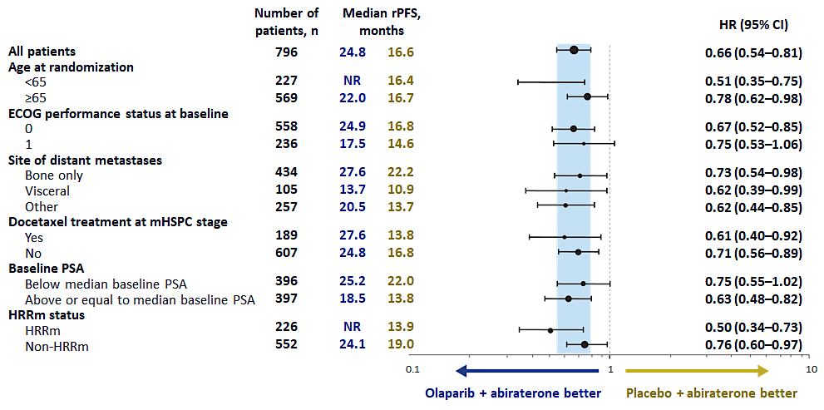
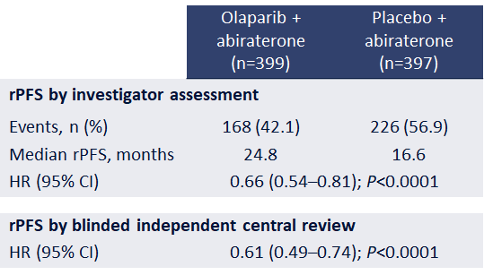
PROpel: Radiographic progression-free survival
Saad F et al. NEJM Evidence; 2022.

Slide 40

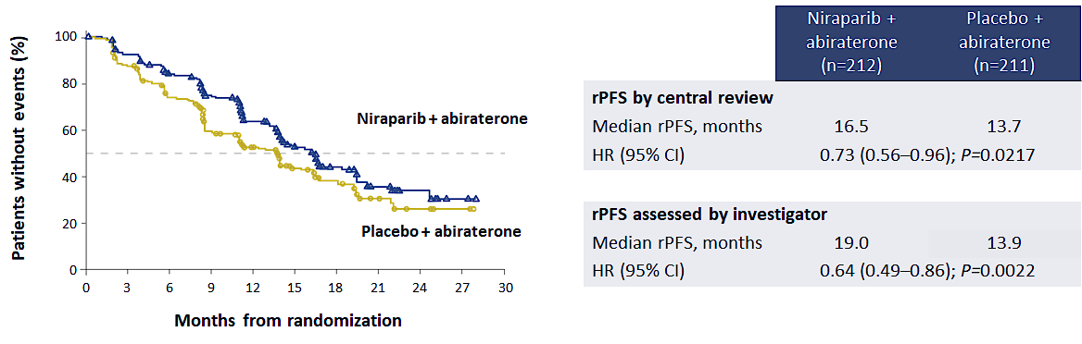

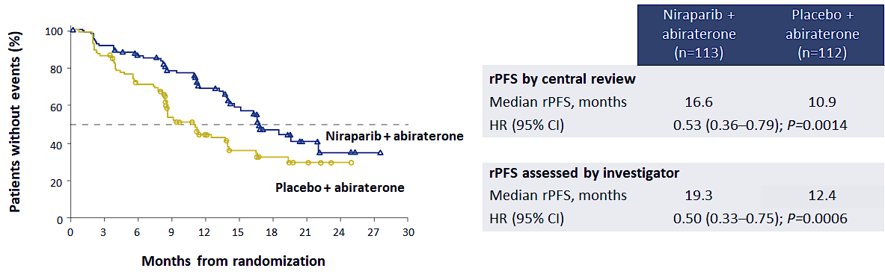
Magnitude: Radiographic progression-free survival
Chi KN et al. J Clin Oncol 2023.

Slide 41
Talapro-2: Phase III Trial of Enza +/– Talazoparib
 | TALA + ENZA (N=402) | PBO + ENZA (N=403)
Events, n | 151 | 191
Median (95% CI), months | NR (27.5–NR) | 21.9 (16.6–25.1)
HR (95% CI) | 0.63 (0.51–0.78); P<0.001
Agarwal N et al. Lancet 2023; 402: 291-303.

Slide 42
Adverse Events across the 3 studies

Slide 43
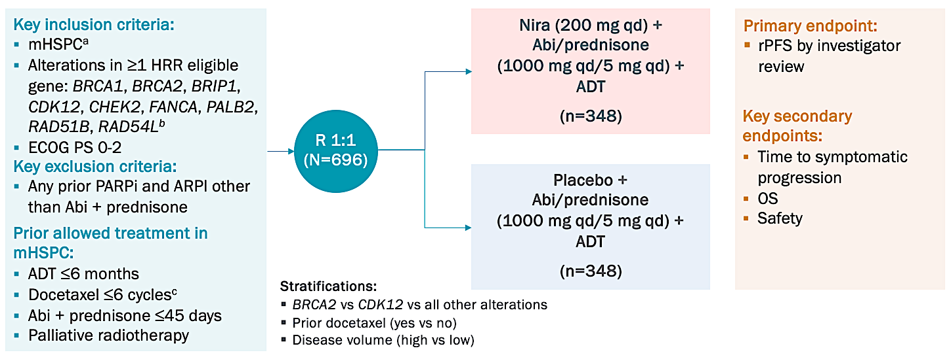
AMPLITUDE: ADT + Abi ± Nira in HRR_{m} mHSPC
Attard G., et al. ASCO Annual 2025, Abstract LBA5006.

Slide 44
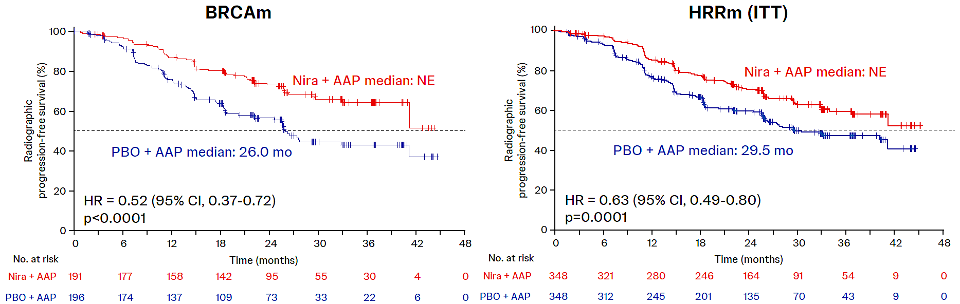
rPFS Outcomes, by HRR_{m} or BRCA1/2_{m} status
Attard G., et al. ASCO Annual 2025, Abstract LBA5006.

Slide 45
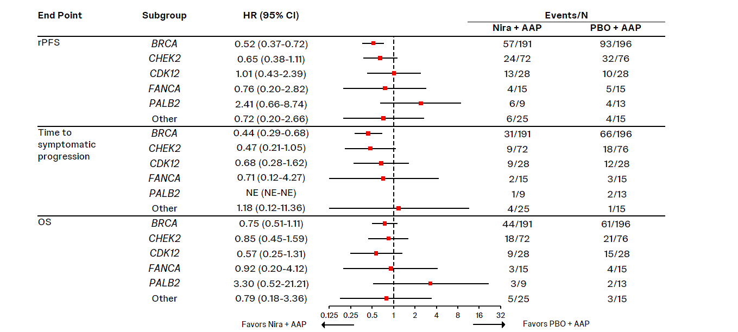
rPFS and OS outcomes, by key HRR genes
Attard G., et al. ASCO Annual 2025, Abstract LBA5006.

Slide 46
Select Ongoing Trials of PARP Inhibitors for mHSPC
Trial Identifier | Phase | Study Population | Treatment Arms | Estimated Primary Completion Date
TALAPRO-3 (NCT04821622) | III | DDR gene mutation | Talazoparib + enzalutamide Placebo + enzalutamide | September 2025
EvoPAR-PR01 (NCT06120491) | III | de novo and recurrent, HRRm and non-HRRm | Saruparib + physician’s choice NHA Placebo + physician’s choice NHA | January 2028
NCT04734730 | II | mHSPC | Talazoparib + abiraterone/ prednisone + ADT | August 2027
NHA = new hormonal agent (abiraterone, darolutamide, enzalutamide)
www.clinicaltrials.gov. Accessed October, 2025.

Slide 47
Ra-223 plus Enzalutamide for first-line bone-metastatic mCRPC patients.

Slide 48
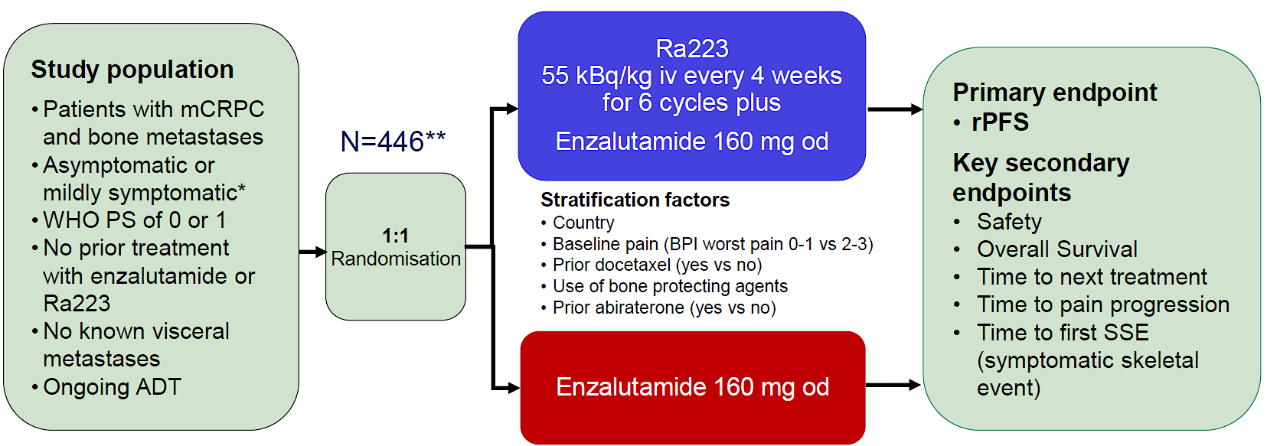

PEACE-3 trial: Enza +/- Radium²²³ in mCRPC
Gillessen S, et al. ESMO 2024; abstract LBA1.
Tombal B, et al. Ann Oncol 2025; 36: 1058-67.

Slide 49
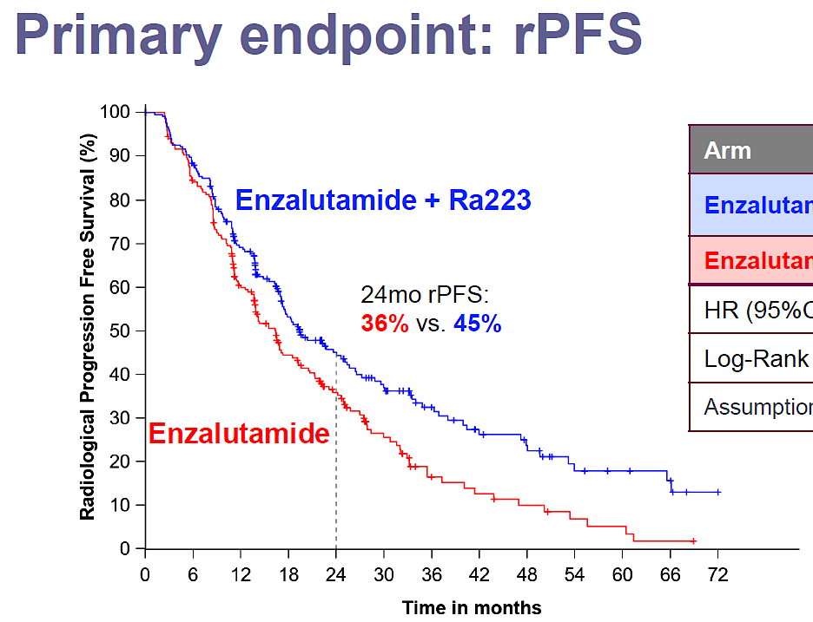
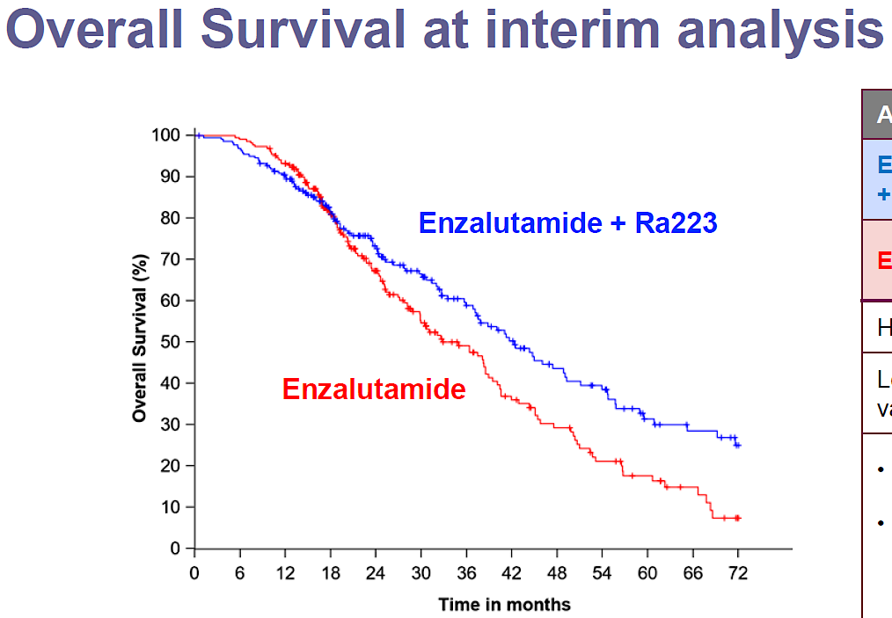
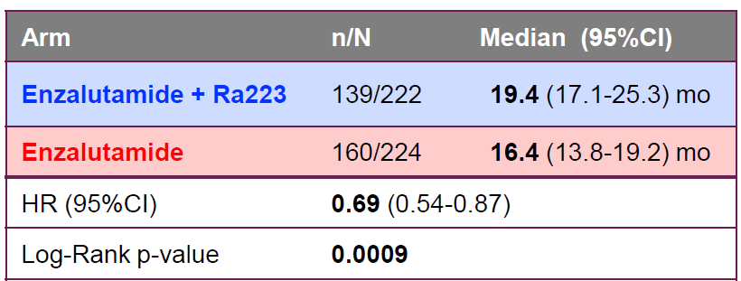
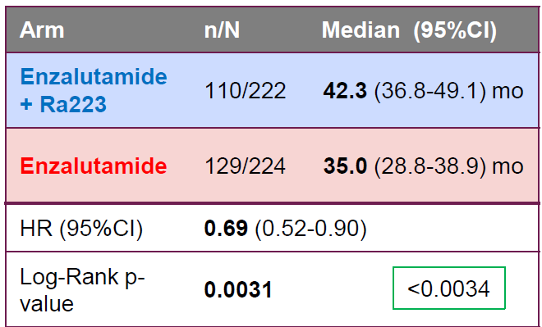
PEACE-3 trial: Enza +/- Radium²²³ in mCRPC
Gillessen S, et al. ESMO 2024; abstract LBA1. Tombal B, et al. Ann Oncol 2025; 36: 1058-67.

Slide 50
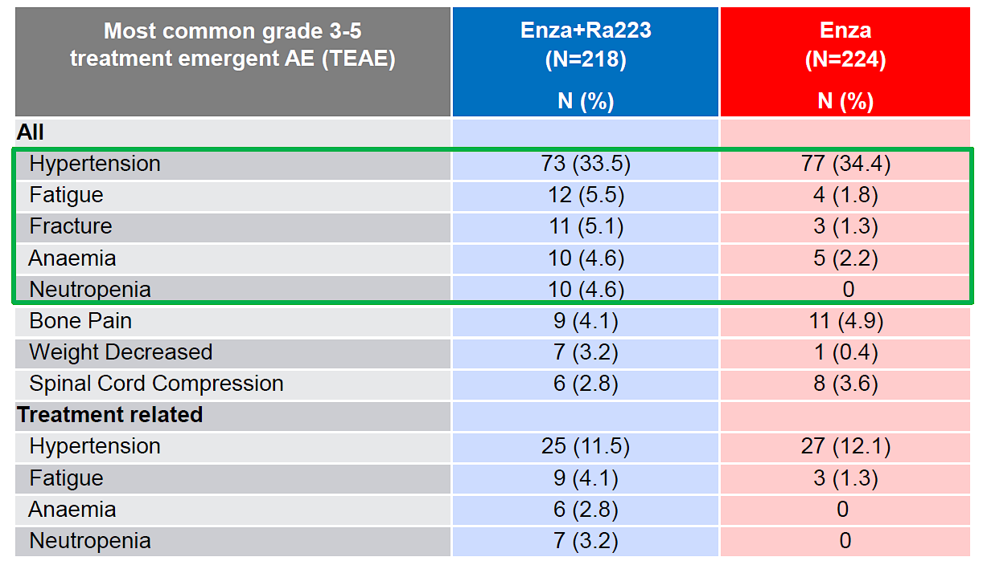
PEACE-3 trial: Adverse Events
Gillessen S, et al. ESMO 2024; Abstract LBA1. Tombal B, et al. Ann Oncol 2025; 36: 1058-67.

Slide 51
Lu-177 vipivotide tetraxetan “radioligand” therapy for advanced prostate cancer.

Slide 52
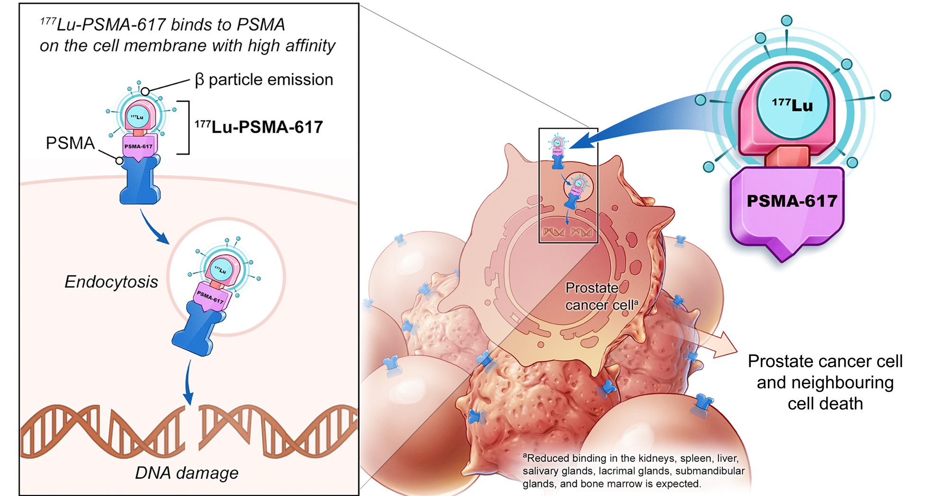
¹⁷⁷Lu-PSMA-617 Radioligand therapy
Morris MJ, et al. J Clin Oncol 39; 2021 (ASCO abstract LBA4).

Slide 53
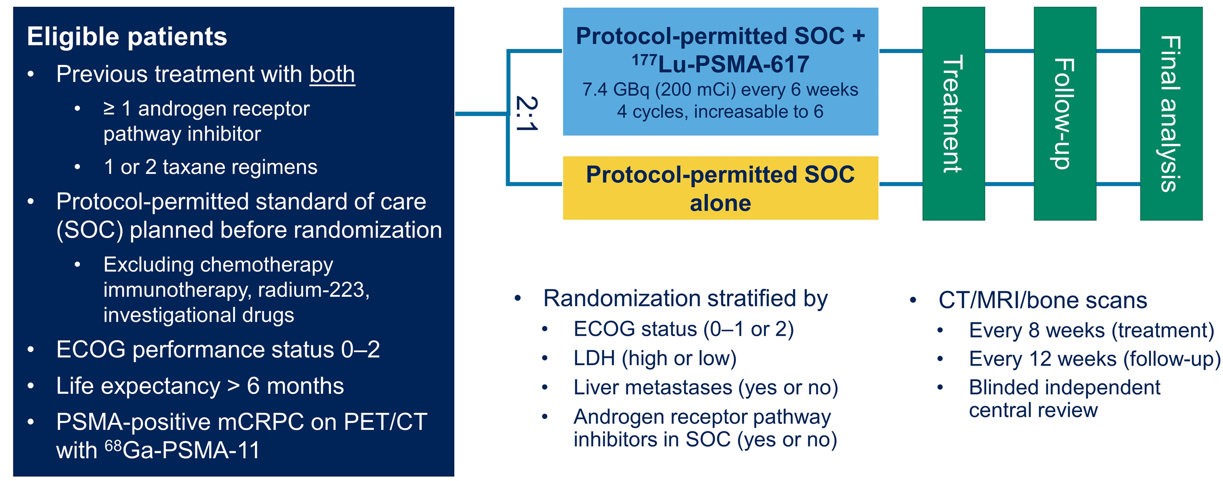
VISION trial for patients with PSMA⁺ mCRPC
Morris MJ, et al. J Clin Oncol 39; 2021 (ASCO abstract LBA4). Sartor O, et al. NEJM 2021; 385: 1091-1103.

Slide 54
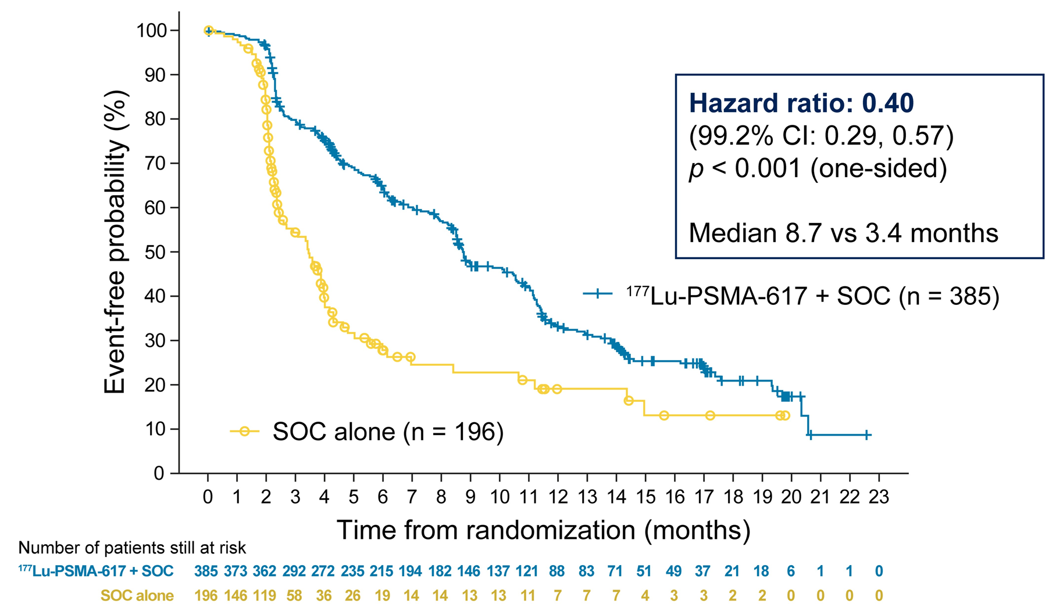
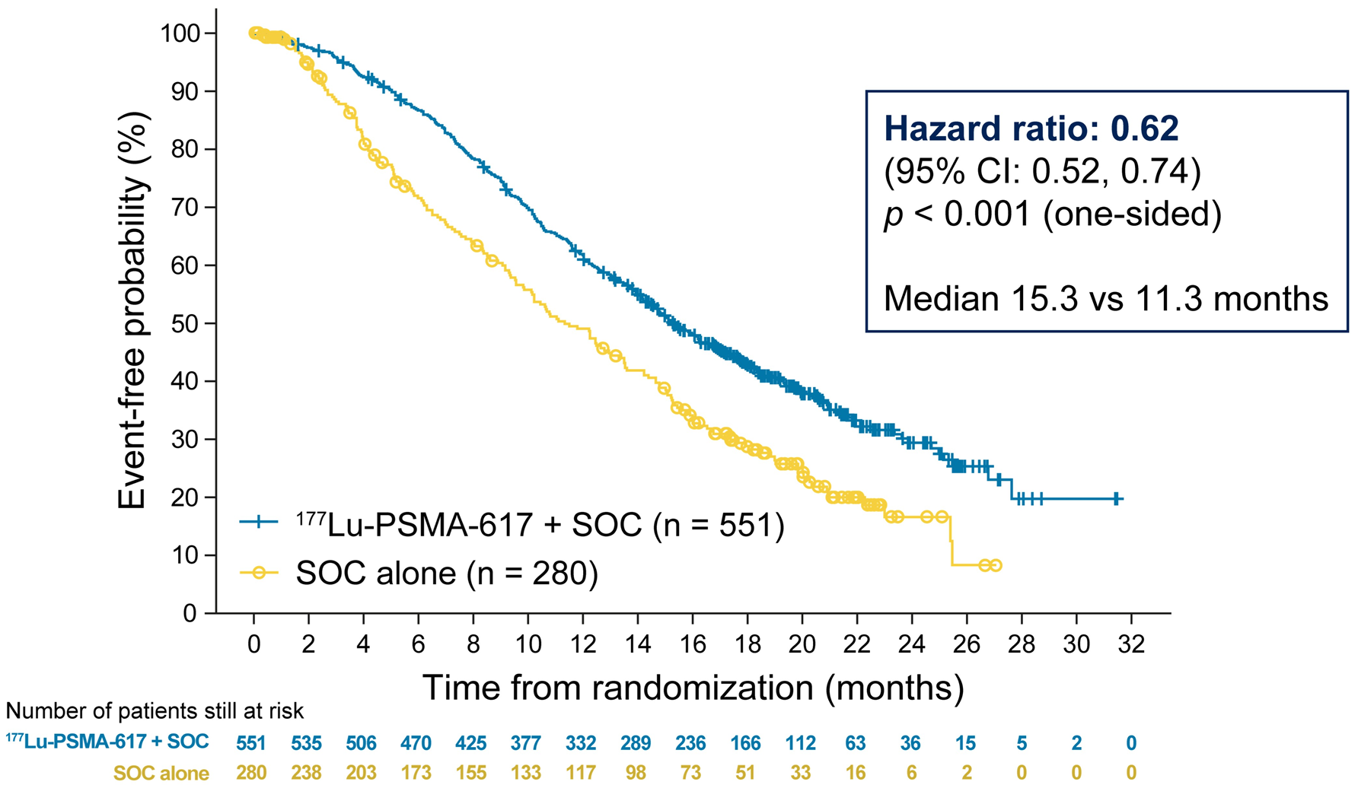
VISION trial: rPFS and OS outcomes
Morris MJ, et al. J Clin Oncol 39; 2021 (ASCO abstract LBA4). Sartor O, et al. NEJM 2021; 385: 1091-1103.

Slide 55
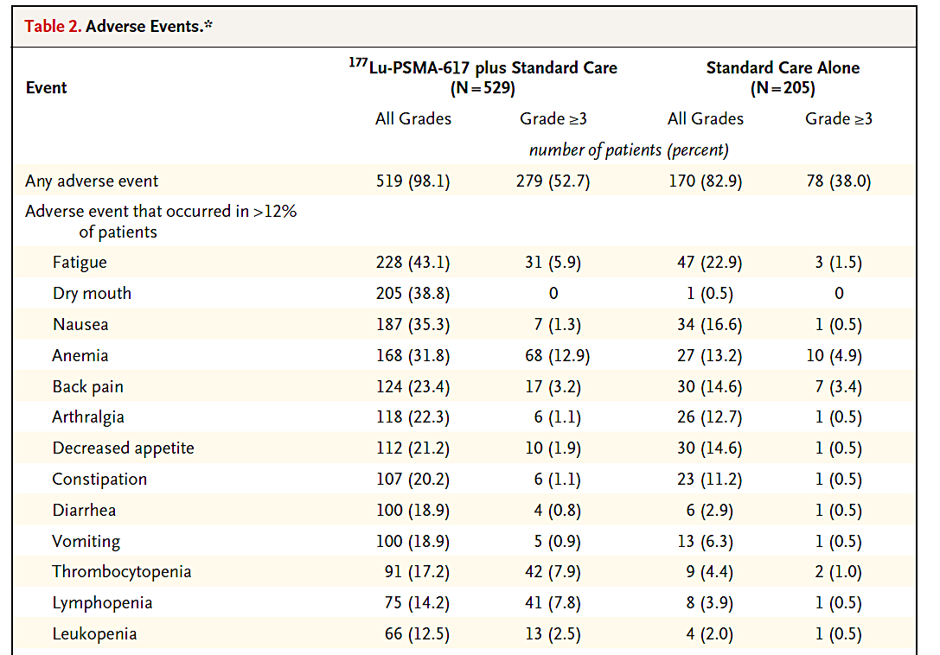
VISION trial: Adverse Events
Sartor O, et al. NEJM 2021; 385: 1091-1103.

Slide 56
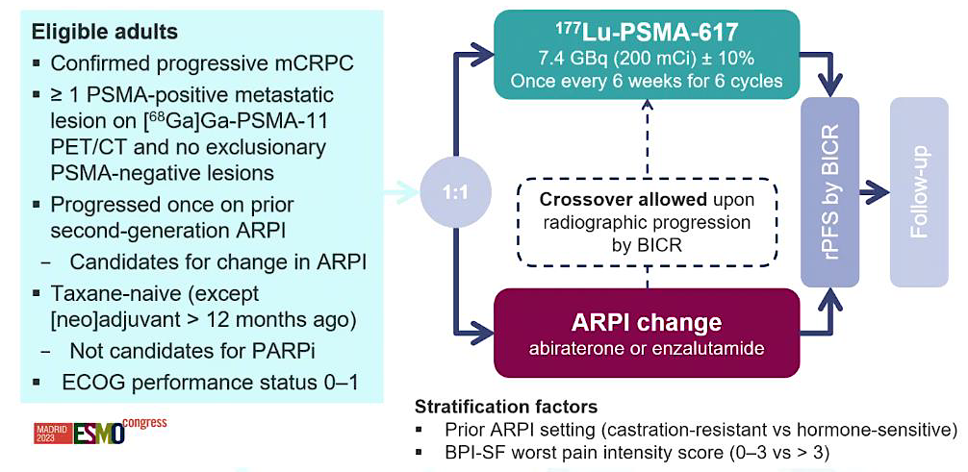
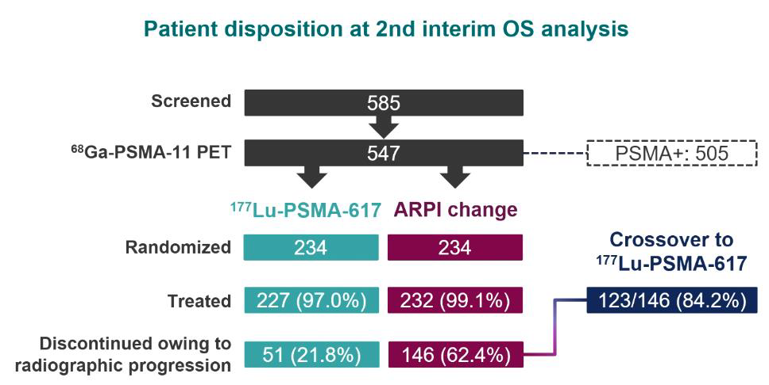
PSMAfore: ¹⁷⁷Lu-PSMA-617 in pre-taxane mCRPC
Morris MJ, et al. Lancet 2024; 404: 1227-39.

Slide 57
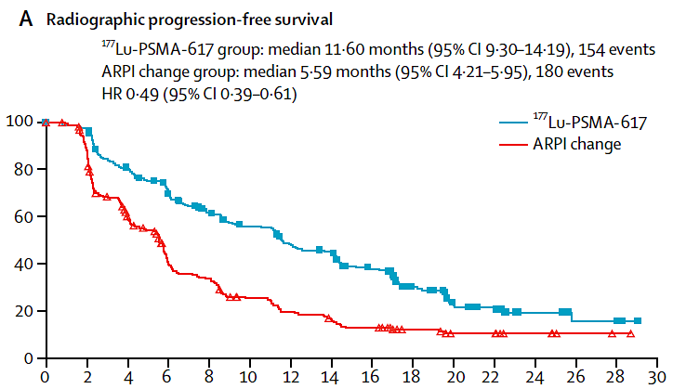
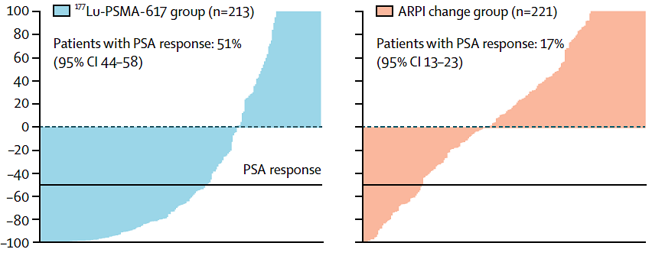
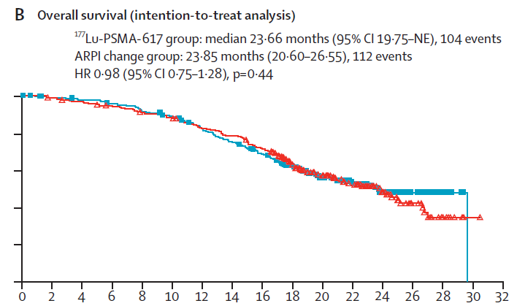

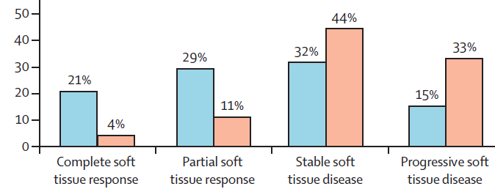
PSMAfore: ¹⁷⁷Lu-PSMA-617 vs. ARPI switch
Morris MJ, et al. Lancet 2024; 404: 1227-39.

Slide 58
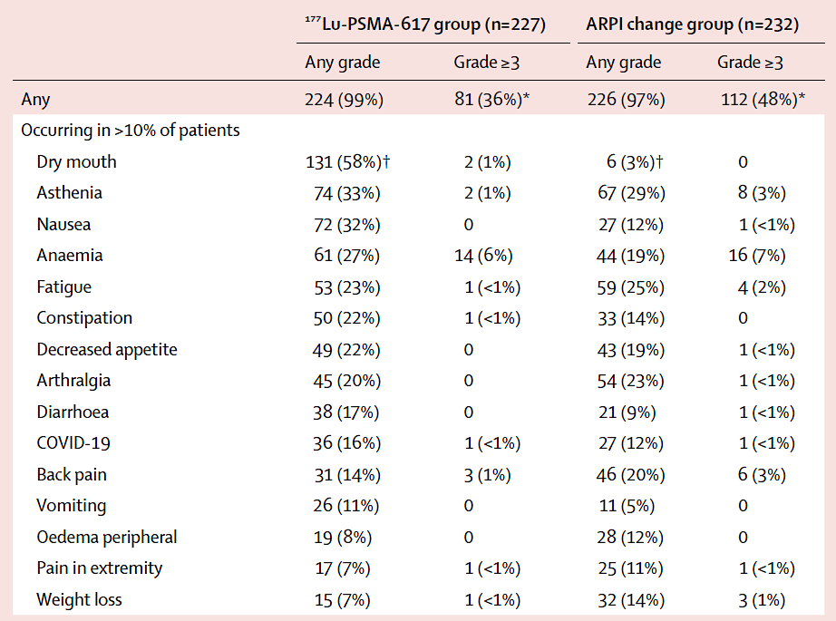
PSMAfore: Adverse Events
Morris MJ, et al. Lancet 2024; 404: 1227-39.

Slide 59
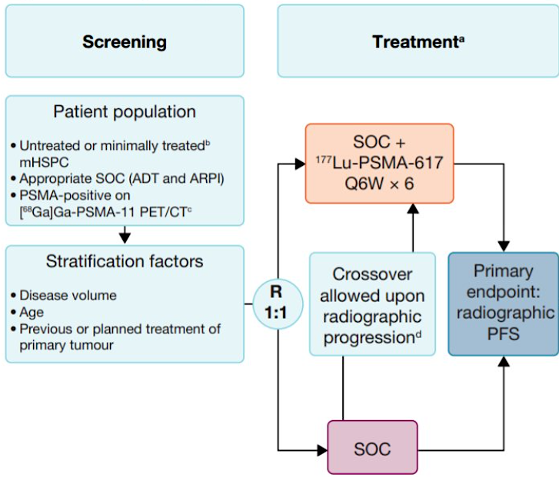

PSMAddition: ADT + ARPI + ¹⁷⁷Lu-PSMA in mHSPC
Tagawa ST, et al. ASCO Annual 2023; Abstract TPS5116. NCT04720157.

Slide 60
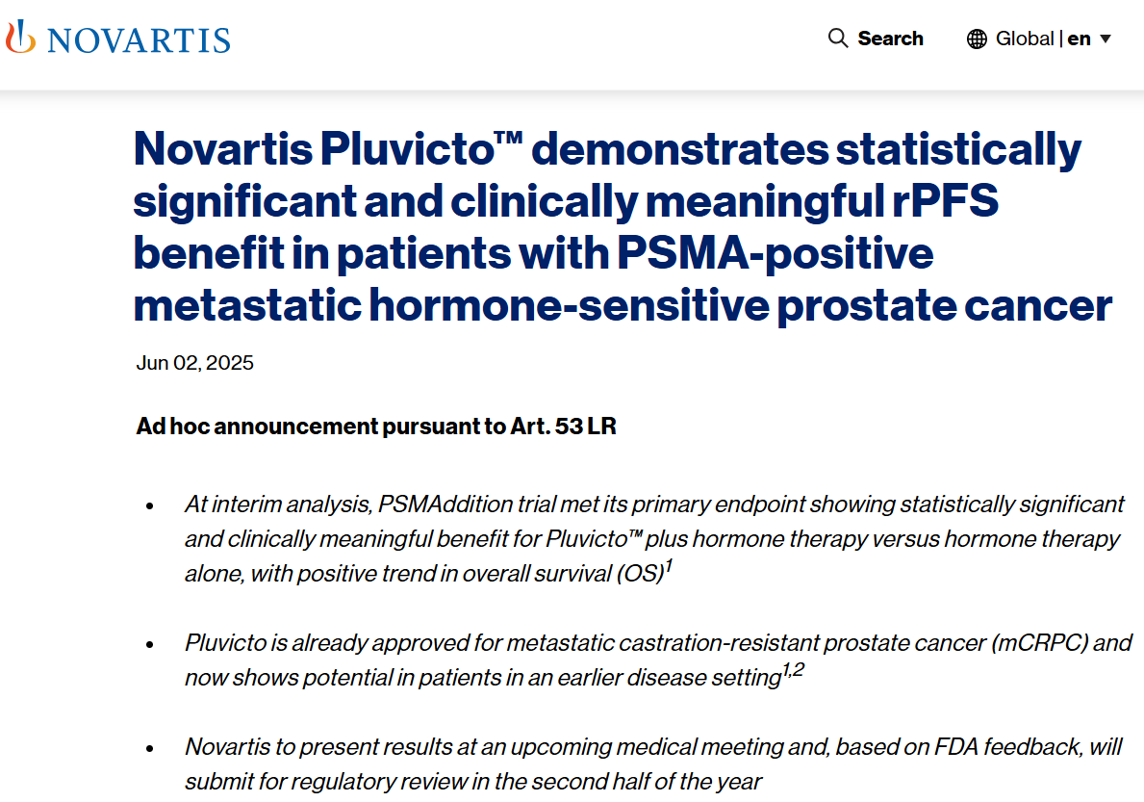
PSMAddition: Press release on 6/2/2025
Lutetium vipivotide tetraxetan demonstrates statistically
¹⁷⁷Lu
¹⁷⁷Lu
Manufacturer to
https://www.novartis.com/news/media-releases/novartis-pluvictotm-demonstrates-statistically-significant-and-clinically-meaningful-rpfs-benefit-patients-psma-positive-metastatic-hormone-sensitive-prostate-cancer

Slide 61
Promising novel agents and strategies for patients with advanced prostate cancer.

Slide 62
Other promising novel agents & strategies
PI3K-AKT-mTOR pathway: Capivasertib
CYP11 inhibition: Opevesostat
AR-targeting PROTACs: Bavdegalutamide, ARV-766, BMS-986365
EZH2 inhibitors: Mevrometostat
B7-H3–targeting Antibody-drug conjugates (ADCs)
Bispecific immune engagers: Xaluritamig, Pasritamig

Slide 63
Data + Perspectives: Clinical Investigators Explore the Application of Recent Datasets in Current Oncology Care
CME/MOC, NCPD and ACPE Accredited
Saturday, October 11, 2025
7:15 AM – 12:30 PM ET

Slide 64
Phase 3 Trial of [177Lu]Lu-PSMA-617 Combined with ADT + ARPI in Patients with PSMA-Positive Metastatic Hormone-Sensitive Prostate Cancer (PSMAddition)
Tagawa ST et al.
ESMO 2025;Abstract LBA6.
PRESIDENTIAL SYMPOSIUM II | SUNDAY, OCTOBER 19 | 17:14 CEST

Slide 65
First Interim Efficacy Analysis of the Phase I/II PETRANHA Trial of Saruparib + Androgen Receptor Pathway Inhibitors (ARPI) in Patients (pts) with Metastatic Prostate Cancer (mPC)
Azad AA et al.
ESMO 2025;Abstract 2384MO.
MINI ORAL | FRIDAY, OCTOBER 17 | 14:35 CEST

Slide 66
Questions from General Medical Oncologists
How do you rate the sensitivity to PARPi of the various HRR abnormalities from a practical perspective? BRCA1/2, PALB2, others? Somatic versus genetic?
In Europe, PARPi are approved for all comers, do you foresee that in the US? Would you like to be able to use these agents for all patients?

Slide 67
Questions from General Medical Oncologists
How do you see integrating PARPi into the management of mHSPC? Which one and how? Are you attempting to do this now?

Slide 68
Questions from General Medical Oncologists
A 71-year-old man with mCRPC and a somatic BRCA1 mutation has disease progression after enzalutamide. Should we switch to a PARPi alone or continue AR-targeted therapy and add a PARPi? Which PARPi?

Slide 69
Questions from General Medical Oncologists
For men with prostate cancer receiving a PARPi, how much of an issue are cytopenias? GI issues? AML/MDS?

Slide 70
Questions from General Medical Oncologists
How do you see integrating ¹⁷⁷Lu-PSMA-617 into the management of mHSPC?
With the potential emergence of several new triplet approaches (PARP, AKT, PSMA) how do you envision selecting between these and currently available approaches for mHSPC?

Slide 71
Questions from General Medical Oncologists
For a patient who is eligible for both radium-223 and ¹⁷⁷Lu-PSMA-617, how do you choose which to use first?

