Slide 1
Data + Perspectives: Clinical Investigators Explore the Application of Recent Datasets in Current Oncology Care CME/MOC, NCPD and ACPE Accredited
Saturday, October 11, 2025 7:15 AM – 12:30 PM ET

Slide 2

Welcome FCS Members!

Slide 3



Clinicians in the Meeting Room
Networked iPads are available.
Review Program Slides: Tap the Program Slides button to review speaker presentations and other program content.
Answer Survey Questions: Complete the premeeting survey.
Ask a Question: Tap Ask a Question to submit a challenging case or question for discussion. We will aim to address as many questions as possible during the program.
For assistance, please raise your hand. Devices will be collected at the conclusion of the activity.
Notes:
3

Slide 4

Clinicians Attending via Zoom
Review Program Slides: A link to the program slides will be posted in the chat room at the start of the program.
Answer Survey Questions: Complete the premeeting surveys.
Ask a Question: Submit a challenging case or question for discussion using the Zoom chat room.
Get CME/ACPE/NCPD Credit: A credit link will be provided in the chat room at the conclusion of the program.
Notes:
4

Slide 5
This educational activity contains discussion of non-FDA-approved uses of agents and regimens. Please refer to official prescribing information for each product for approved indications.

Slide 6
Practical Perspectives: Experts Review Actual Cases of Patients with Endometrial Cancer
A CME/MOC-Accredited Live Webinar
Wednesday, October 15, 2025 5:00 PM – 6:00 PM ET
Faculty
Kathleen N Moore, MD, MS
Matthew A Powell, MD
Moderator
Neil Love, MD

Slide 7
Practical Perspectives: Experts Review Actual Cases of Patients with HER2-Positive Gastrointestinal Cancers
A CME/MOC-Accredited Live Webinar
Tuesday, October 21, 2025​ 5:00 PM – 6:00 PM ET
Faculty
Tanios Bekaii-Saab, MD
Kristen K Ciombor, MD, MSCI
Moderator
Neil Love, MD

Slide 8
Cancer Q&A: Understanding the Role and Reality of CAR (Chimeric Antigen Receptor) T-Cell Therapy for Non-Hodgkin Lymphoma
A Webinar Series for Clinicians and Patients, Developed in Partnership with CancerCare®
Patients
Clinicians
Wednesday, October 22, 2025
6:00 PM – 7:00 PM ET
Wednesday, November 12, 2025
5:00 PM – 6:00 PM ET
Faculty
Jeremy S Abramson, MD, MMSc
Loretta J Nastoupil, MD
Moderator
Neil Love, MD

Slide 9
Exploring Current Patterns of Care in the Community: Optimizing the Use of Oral Selective Estrogen Receptor Degraders for HR-Positive Metastatic Breast Cancer
A CME/MOC-Accredited Live Webinar
Wednesday, October 29, 2025 5:00 PM – 6:00 PM ET
Faculty
Rinath M Jeselsohn, MD
Joyce O’Shaughnessy, MD
Moderator
Neil Love, MD

Slide 10
What Clinicians Want to Know: First-Line and Maintenance Therapy for Patients with Extensive-Stage Small Cell Lung Cancer
A CME/MOC-Accredited Live Webinar
Tuesday, November 11, 2025 5:00 PM – 6:00 PM ET
Faculty
Luis Paz-Ares, MD, PhD
Misty Dawn Shields, MD, PhD
Moderator
Neil Love, MD

Slide 11
Cancer Conference Update: 2025 ESMO Annual Meeting — Breast Cancer Highlights
CME/MOC-Accredited Live Webinar
Thursday, November 13, 2025​ 5:00 PM – 6:00 PM ET
Faculty
Professor Giuseppe Curigliano, MD, PhD
Priyanka Sharma, MD
Moderator
Neil Love, MD

Slide 12
Exciting CME Events You Do Not Want to Miss
A Friday Satellite Symposium Series Preceding the 67th ASH Annual Meeting
Friday, December 5, 2025
Acute Myeloid Leukemia
7:30 AM – 9:30 AM ET
Myelofibrosis and Systemic Mastocytosis
3:15 PM – 5:15 PM ET
Chronic Lymphocytic Leukemia
11:30 AM – 1:30 PM ET
Follicular Lymphoma and
Diffuse Large B-Cell Lymphoma
7:00 PM – 9:00 PM ET

Slide 13
Cases from the Community: Investigators Discuss the Optimal Management of Breast Cancer
A 3-Part CME Satellite Symposium Series
Antibody-Drug Conjugates for
Metastatic Breast Cancer
Tuesday, December 9, 2025
7:00 PM – 8:30 PM CT
HER2-Positive Breast Cancer
Wednesday, December 10, 2025
7:00 PM – 9:00 PM CT
Endocrine-Based Therapy
Thursday, December 11, 2025
7:00 PM – 9:00 PM CT
Moderator
Neil Love, MD

Slide 14
Optimizing Treatment for Patients with Relapsed/Refractory Chronic Lymphocytic Leukemia
A CME/MOC-Accredited Interactive Grand Rounds Series
October 2025 to March 2026
Steering Committee
Catherine C Coombs, MD
Matthew S Davids, MD, MMSc
Bita Fakhri, MD, MPH
Nicole Lamanna, MD
Jeff Sharman, MD
Jennifer Woyach, MD
Host a 1-hour session at your institution: Email Meetings@ResearchToPractice.com or call (800) 233-6153

Slide 15

Save The Date
A Multitumor CME/MOC-, NCPD- and ACPE-Accredited Educational Conference Developed in Partnership with Florida Cancer Specialists & Research Institute
Friday to Sunday, April 24 to 26, 2026
The Ritz-Carlton Orlando, Grande Lakes | Orlando, Florida
Moderated by Neil Love, MD

Slide 16
RTP Content Production (Hours) 9/1/24 — 8/31/25
Podcast
Streaming Platforms (YouTube, Spotify)
 | Year | Month
Total | 281 | 24 (12-31)
Final* | 199 | 16 (9-31)
Recordings | 93 | 8 (0-15)
Webinars | 41 | 4 (0-6)
Cases | 62 | 5 (2-6)
Meetings | 94 | 8 (0-18)
Email
Social Media
App
Website
Text Messages
*Presentations = 50 hours; Discussions = 150 hours
QR Code Cards

Slide 17
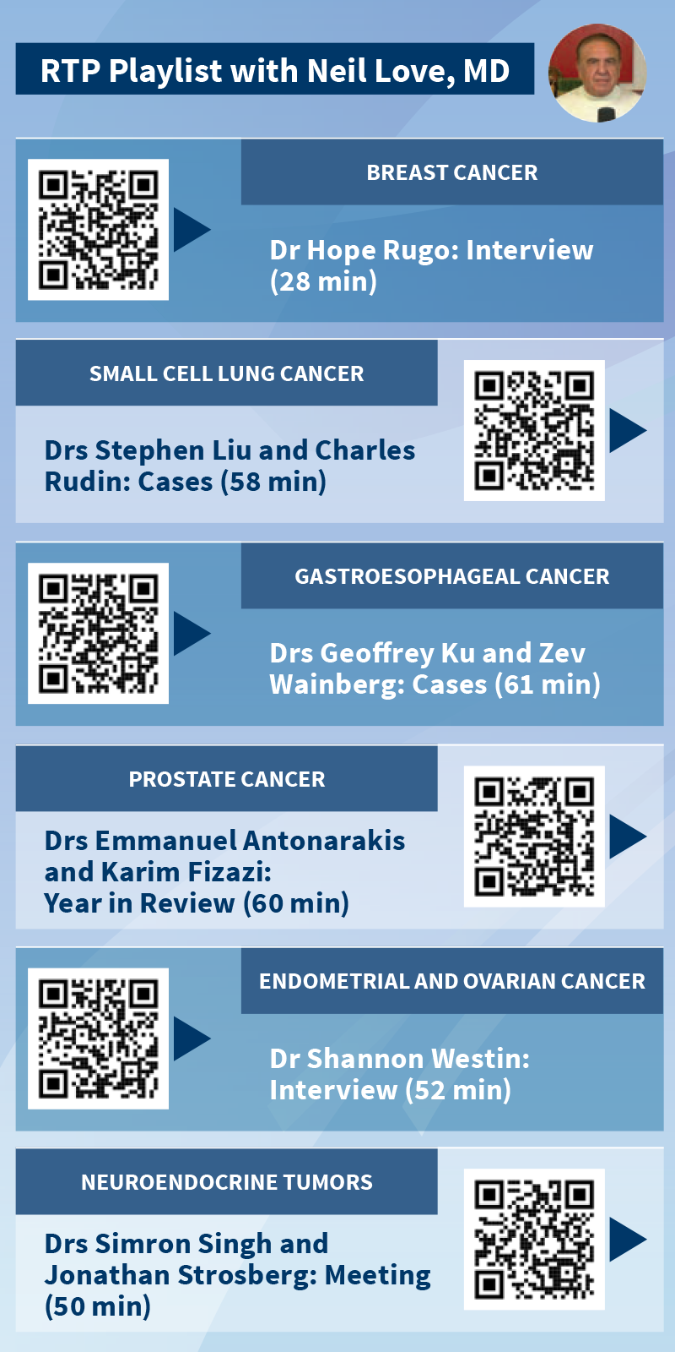
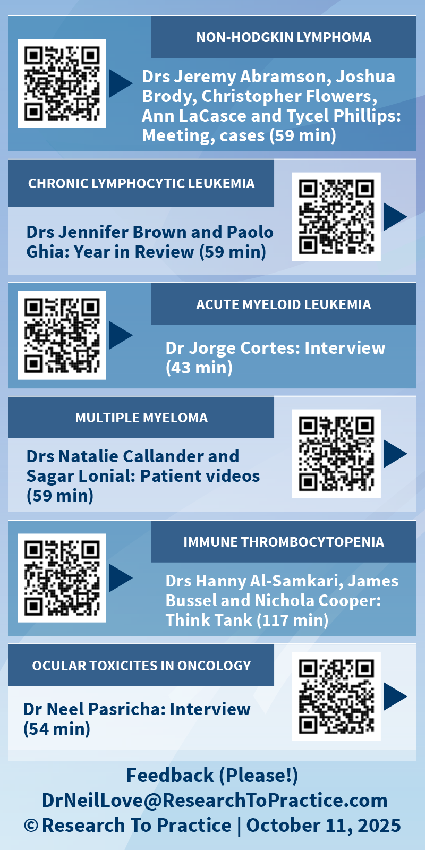

Slide 18
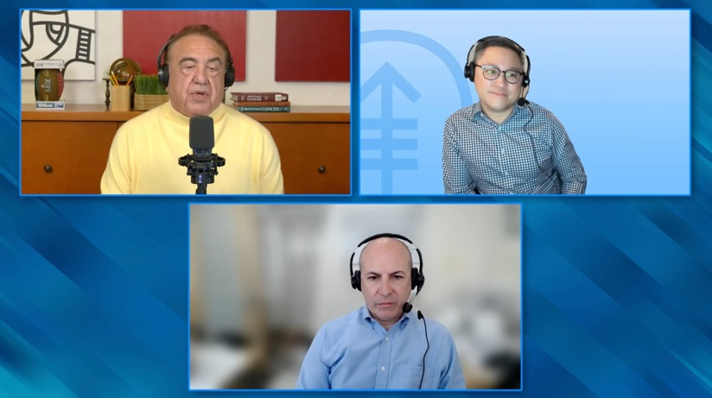
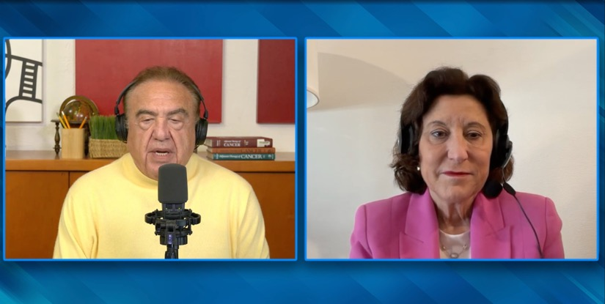
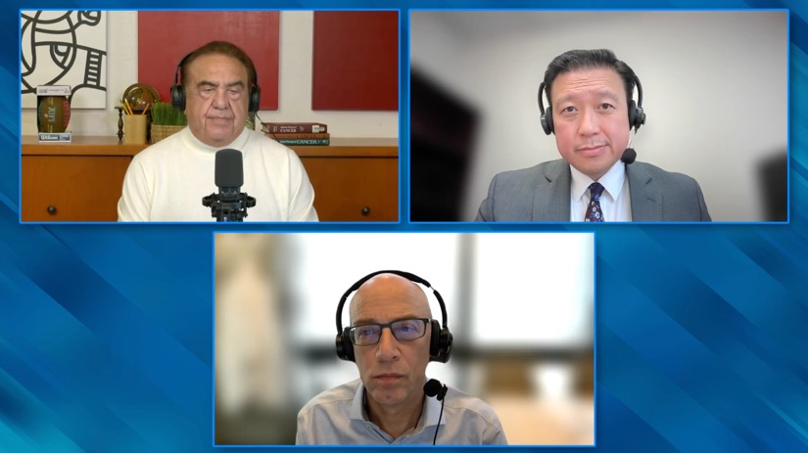
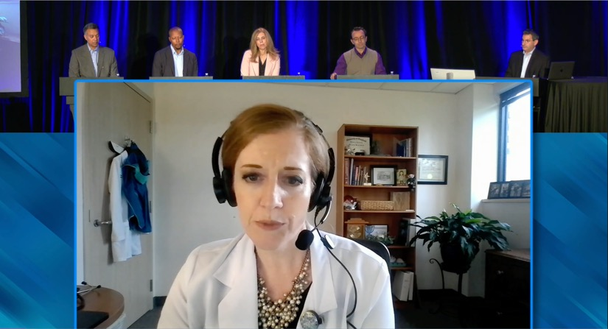

Slide 19
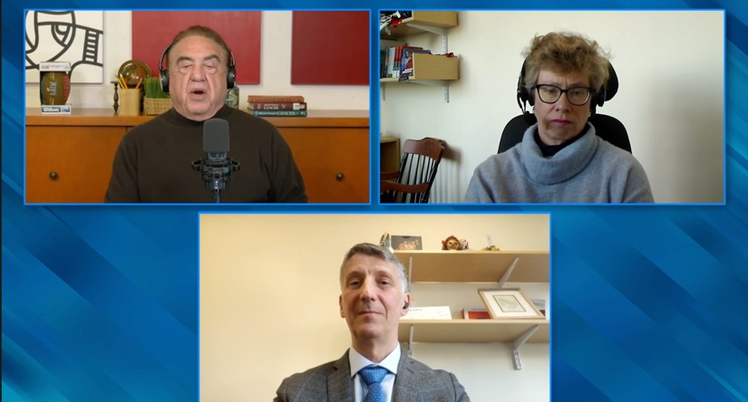
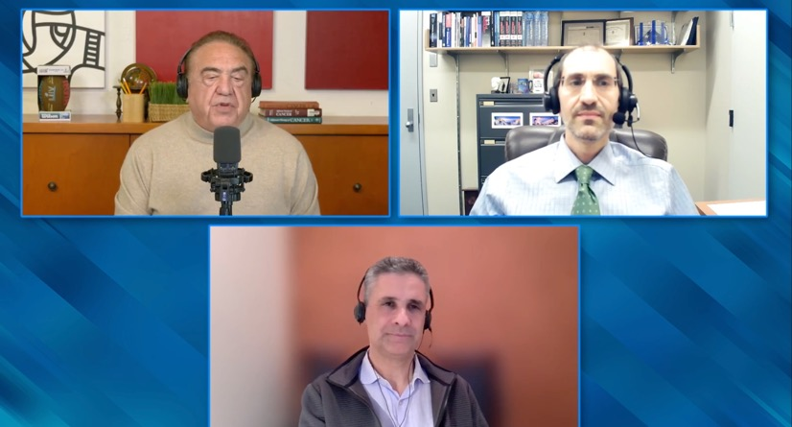
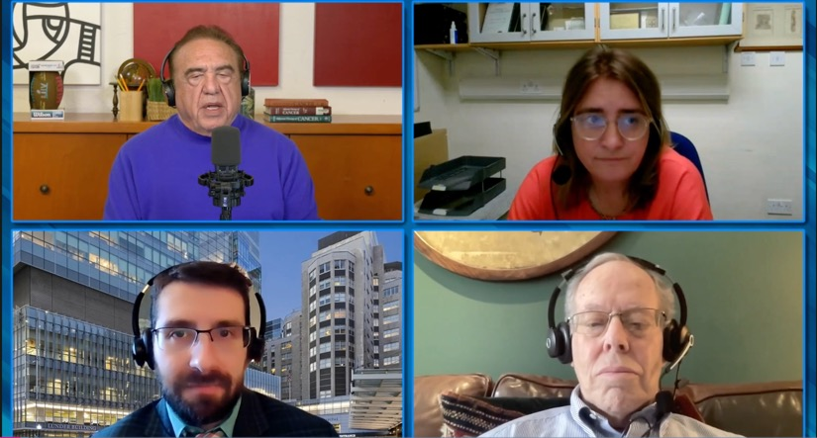


Slide 20
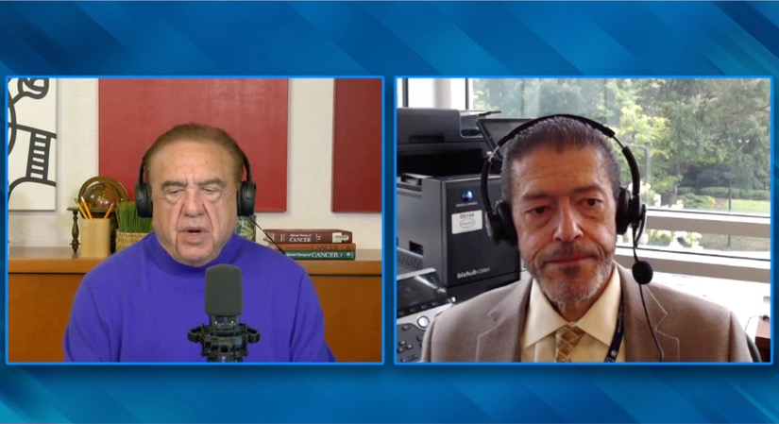
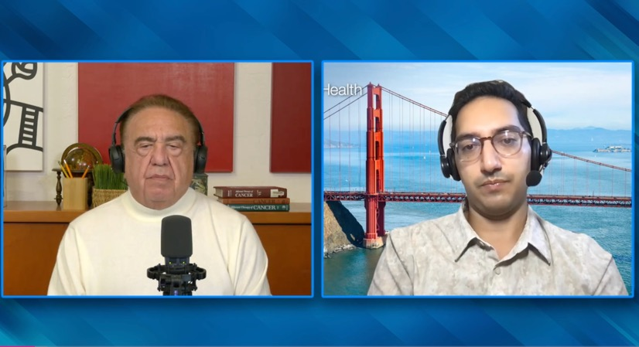
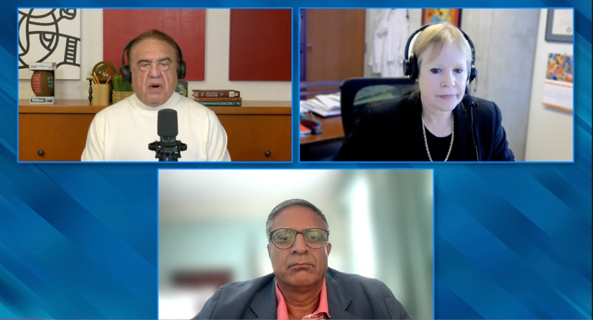

Slide 21
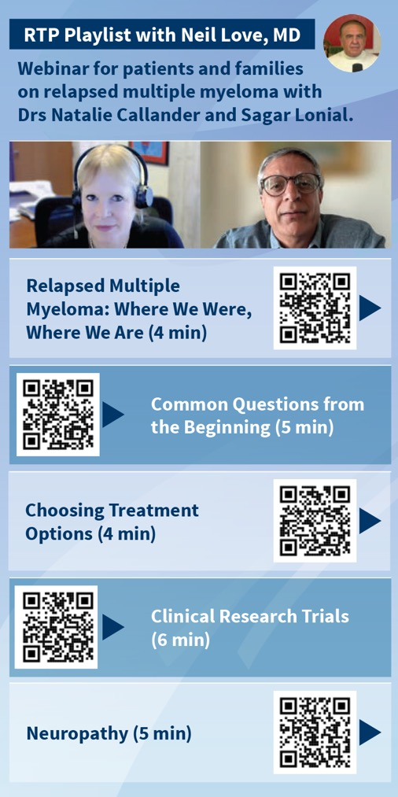
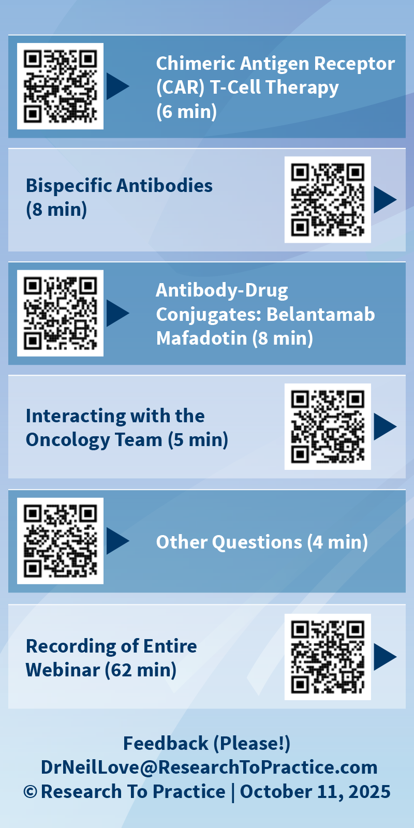

Slide 22



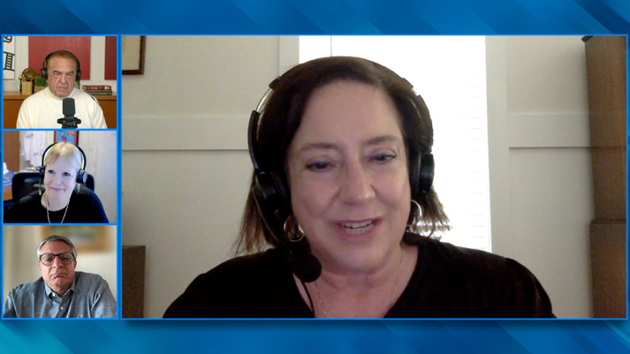

Slide 23

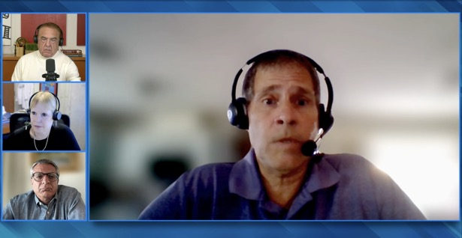


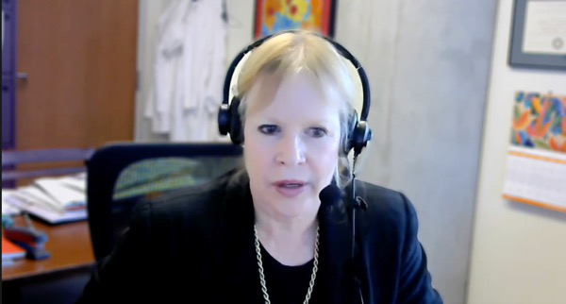
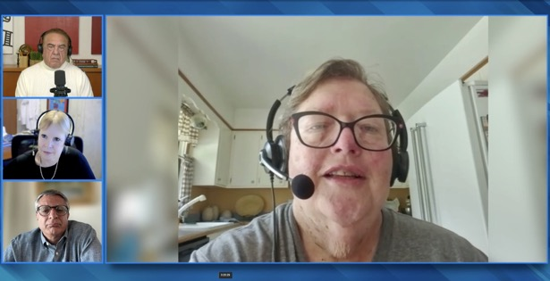

Slide 24
Survey of Attendees and Other Community-Based General Medical Oncologists
September 30 – October 8, 2025

Slide 25
Agenda
Module 1 — Breast Cancer: Drs Burstein, Goetz, McArthur and Nanda
Module 2 — Prostate Cancer: Drs Antonarakis and M Smith
Module 3 — Colorectal Cancer: Drs Lieu and Strickler
Module 4 — Diffuse Large B-Cell Lymphoma and Follicular Lymphoma: Drs Lunning and S Smith

Slide 26
Agenda
Module 1 — Breast Cancer: Drs Burstein, Goetz, McArthur and Nanda
Module 2 — Prostate Cancer: Drs Antonarakis and M Smith
Module 3 — Colorectal Cancer: Drs Lieu and Strickler
Module 4 — Diffuse Large B-Cell Lymphoma and Follicular Lymphoma: Drs Lunning and S Smith

Slide 27




Breast Cancer
Harold J Burstein, MD, PhD
Director of Academic Partnerships
Institute Physician
Dana-Farber Cancer Institute
Professor of Medicine
Harvard Medical School
Boston, Massachusetts
Heather McArthur, MD, MPH, FASCO
Professor, Department of Internal Medicine
Clinical Director, Breast Cancer Program
Komen Distinguished Chair in Clinical Breast Cancer Research
UT Southwestern Medical Center
Dallas, Texas
Matthew P Goetz, MD
Erivan K Haub Family Professor of Cancer Research Honoring Richard F Emslander, MD
Professor of Oncology and Pharmacology
Department of Oncology
Mayo Clinic
Rochester, Minnesota
Rita Nanda, MD
Director, Breast Oncology
Associate Professor of Medicine
Section of Hematology/Oncology
The University of Chicago
Chicago, Illinois

Slide 28

Localized Hormone Receptor (HR)-Positive Breast Cancer (BC); Initial Therapy for Metastatic Disease
FCS 2025 Symposium
Matthew P. Goetz, M.D.
Erivan K. Haub Family Professor of Cancer Research Honoring Richard F. Emslander, M.D.
Mayo Clinic
Rochester, MN USA

Slide 29
Outline
Key studies informing the use of the 21-gene Recurrence Score (RS) to guide treatment decision-making for patients with HR-positive, HER2-negative BC
Extended follow-up with the addition of abemaciclib and ribociclib, respectively, to standard adjuvant endocrine therapy for patients with localized HR-positive, HER2- negative BC
Long-term follow-up from key clinical trials of approved CDK4/6 inhibitors in patients with HR-positive, HER2-negative metastatic BC
Published data from the Phase III SERENA-6 trial of early therapeutic switching from an aromatase inhibitor to camizestrant after detection of an emergent ESR1 mutation during first-line therapy for HR-positive, HER2-negative mBC

Slide 30
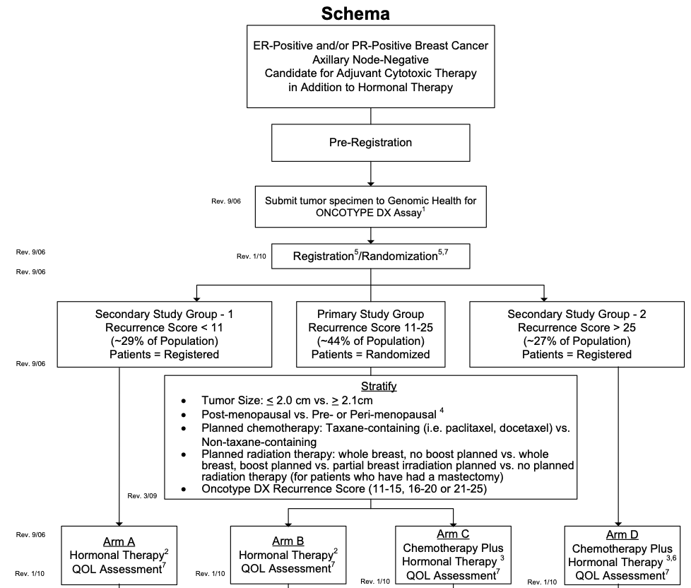
PACCT-1: Prospective Validation of 21-Gene Recurrence Score (RS)
https://clinicaltrials.gov/study/NCT00310180.

Slide 31
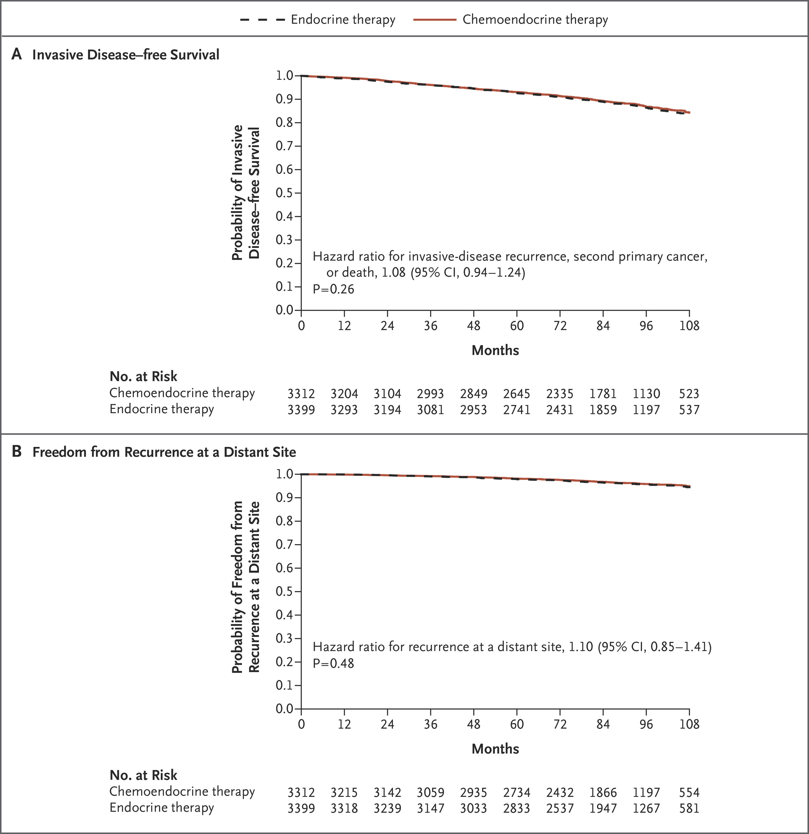
PACCT-1: Clinical Outcomes (RS 11 to 25)
Invasive Disease-Free Survival
Freedom from Recurrence at a Distant Site
Sparano JA et al. N Engl J Med. 2018;379:111-121.

Slide 32
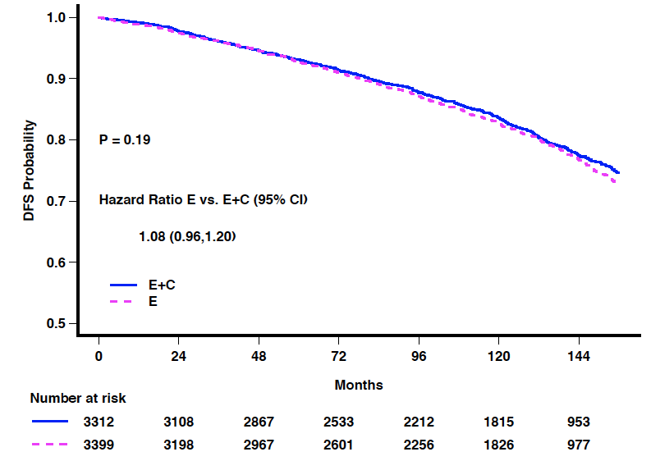
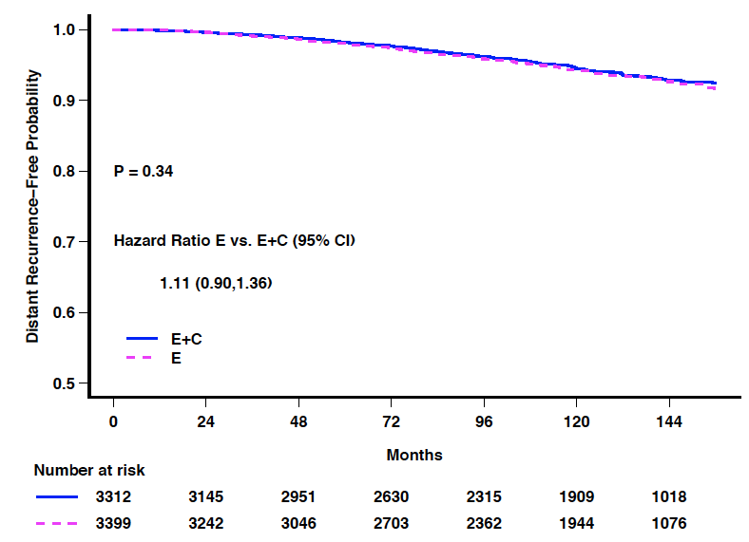
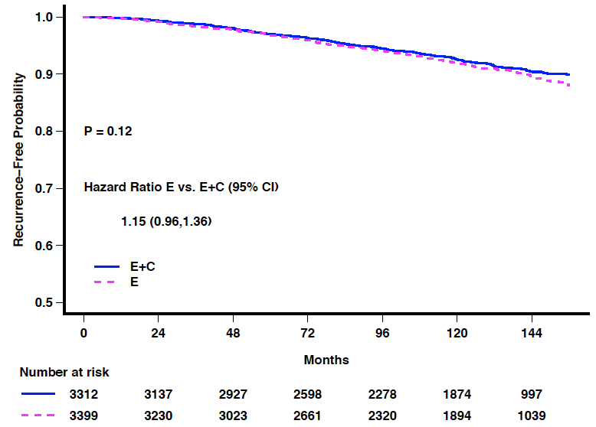
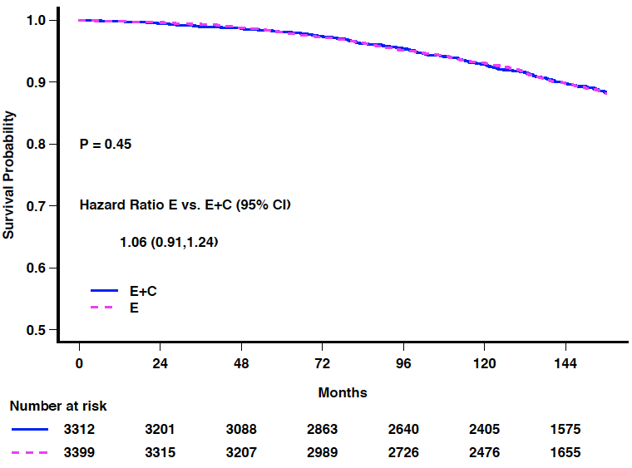
TAILORx: Updated Analysis - Kaplan-Meier Curves in RS 11-25 Arms (ITT population)
Primary trial conclusions unchanged: ET non-inferior to CET (N=6711)
IDFS
P=0.19
DRFI
P=0.34
Event | Hazard Ratio: Arm B vs. C (95% CI)
IDFS | Primary analysis: 1.08 (0.94, 1.24, p=0.26)
 | Updated analysis: 1.08 (0.96, 1.20)
DRFI | Primary analysis: 1.10 (0.85,1.41, p=0.48)
 | Updated analysis: 1.11 (0.90, 1.36)
RFI | Primary analysis: 1.11 (0.90, 1.37, p=0.33)
 | Updated analysis: 1.15 (0.96, 1.36)
OS | Primary analysis: 0.99 (0.79, 1.22, p=0.89)
 | Updated analysis: 1.06 (0.91, 1.24)
RFI
P=0.12
OS
P=0.46
RFI
Sparano JA et al. SABCS 2022;Abstract GS01-05

Slide 34
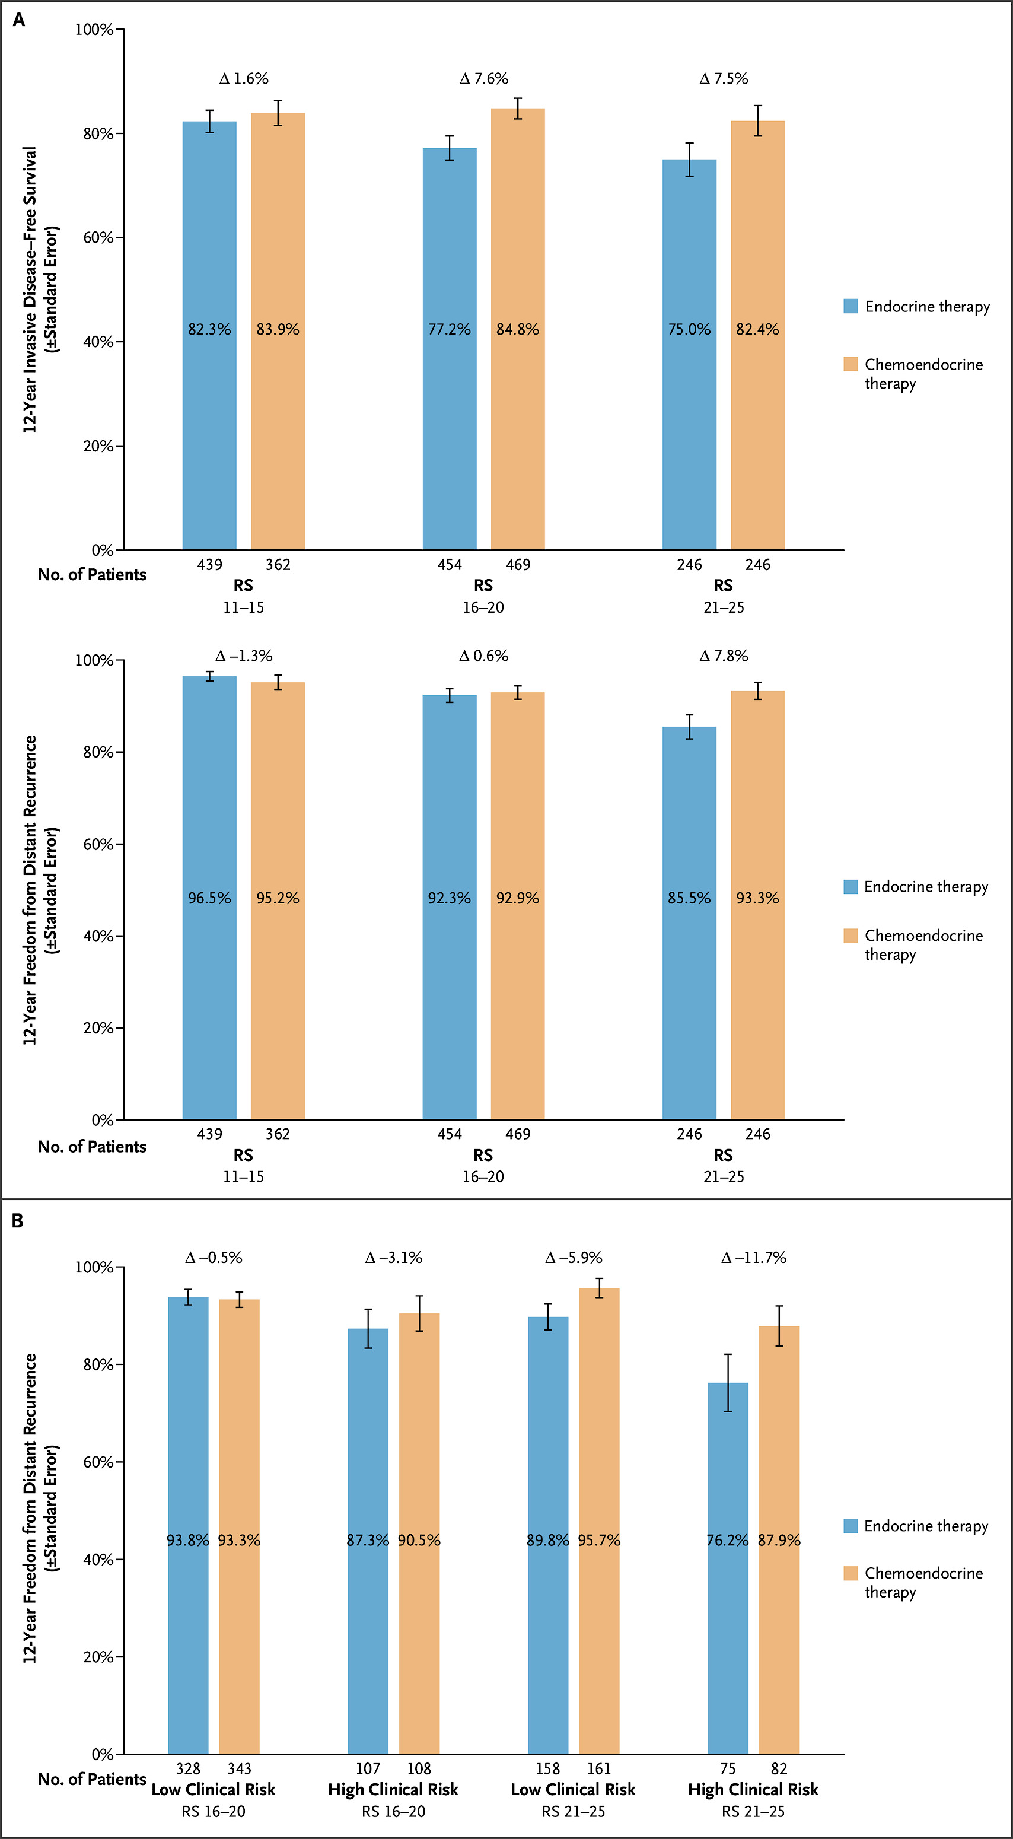
Development and validation of the RSClin educational tool integrating the 21-gene RS and clinicopathologic features
Sparano JA et al. NEJM Evid. 2024 Aug;3(8):EVIDoa2300267.

Slide 35
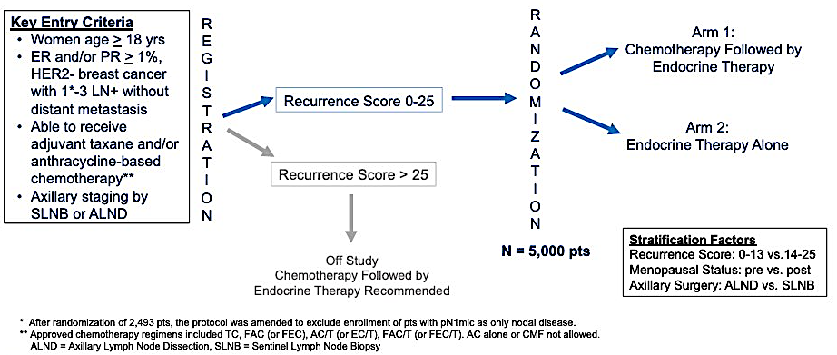
RxPONDER: Study Design
Kalinsky K et al. SABCS 2020;Abstract GS3-00

Slide 36
IDFS Stratified by Recurrence Score and Menopausal Status
Postmenopausal
Premenopausal
Premenopausal patients:
84% and 75% received tamoxifen monotherapy in the chemo-endocrine and endocrine alone arms
RS 0-13
RS 0-13
No Statistically Significant IDFS Difference
5-year IDFS Absolute Difference 3.9%
RS 14-25
RS 14-25
No Statistically Significant IDFS Difference
5-year IDFS Absolute Difference 6.2%
Kalinsky K et al. SABCS 2020;Abstract GS3-00

Slide 37
Summary
In RxPONDER, the addition of chemotherapy to endocrine therapy did not significantly improve IDFS
Similar to TAILORx, an effect of age and menopausal status continues to be seen:
No benefit in postmenopausal women
In age <50, clear benefit of chemotherapy regardless of RS
Similar findings in MINDACT
In TAILORx, RxPonder, and MINDACT, the predominant adjuvant hormonal therapy for premenopausal patients was tamoxifen (without OFS)
NRG 009 will answer whether the addition of chemotherapy to optimal endocrine therapy (AI + OFS) significantly improves outcomes in premenopausal women with ER+/HER2- breast cancer

Slide 38
Adjuvant CDK4/6i Trials
Trial Name | N | CDK4/6i | Duration of CDKi | Eligibility | IDFS HR
Penelope-B | 1250 | Palbociclib | 1 y | Residual disease after 16 wk of neoadjuvant CT CPS-EG score ≥3 or 2 with ypN+ | HR = 0.93 (95% CI: 0.74-1.17) P = .53
PALLAS | 5761 | Palbociclib | 2 y | Stage II-III | HR = 0.96 (95% CI: 0.81-1.14) P = .65
monarchE | 5637 | Abemaciclib | 2 y | >4 ALN or 1-3 ALN and at least 1 below: T >5 cm G3 Ki-67 >20% | HR = 0.680 (95% CI: 0.599-0.772) Nominal P < .001
NATALEE | 5101 | Ribociclib | 3 y | Stage II (either N0 with grade 2-3 and/or Ki67 ≥20% or N1) or III | HR = 0.749 (95% CI: 0.628-0.892) P = .0012
Loibl S et al. J Clin Oncol. 2021;39:1518-1530. Gnant M et al. J Clin Oncol. 2022;40:282-293. Rastogi P et al. J Clin Oncol. 2024 Mar 20;42(9):987-993. Hortobagyi GN et al. Ann Oncol. 2025 Feb;36(2):149-157.

Slide 39
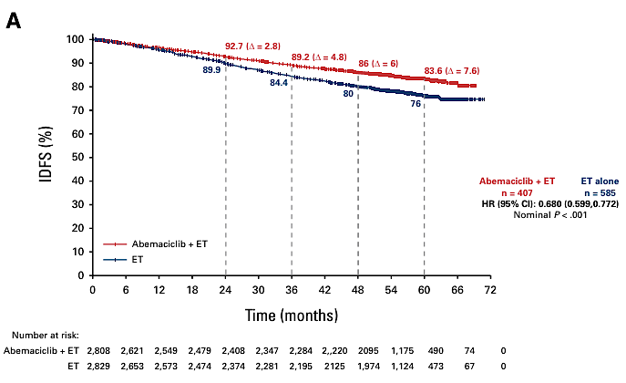
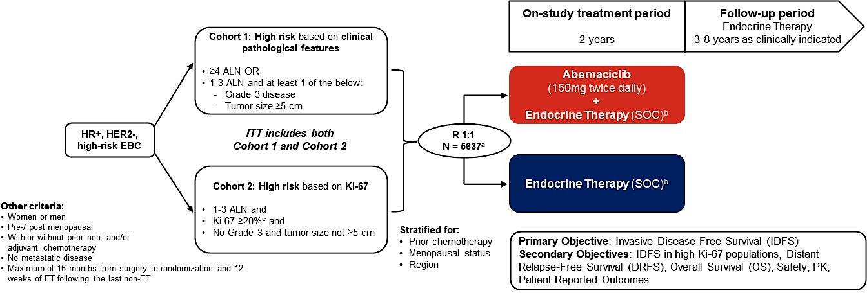
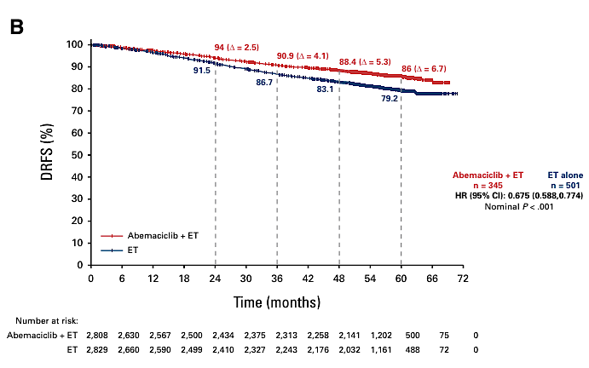
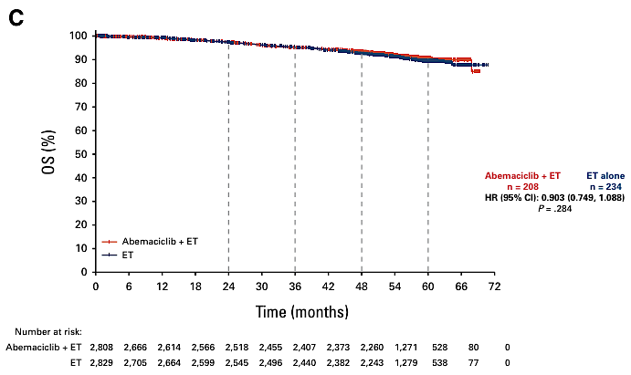
MonarchE
iDFS
Median FU
54 months (IQR, 49-59).
OS
DRFS
Rastogi et al J Clin Oncol 2024: 42: 987-993

Slide 40
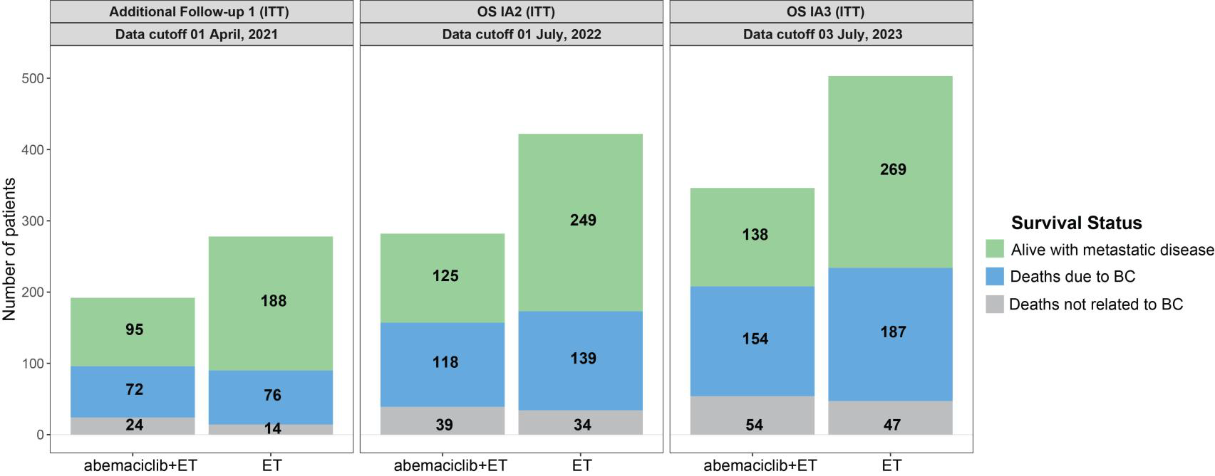
monarchE: Interim OS Analysis
Harbeck N. ESMO 2023;Abstract LBA17.

Slide 41
Abemaciclib increases overall survival in HR+, HER2-, high-risk early breast cancer with two years of therapy Press Release: August 27, 2025
“[The manufacturer] today announced positive topline results from the primary overall survival (OS) analysis of the Phase 3 monarchE trial. Treatment with two years of abemaciclib plus endocrine therapy (ET) demonstrated a statistically significant and clinically meaningful improvement in OS compared to ET alone in patients with hormone receptor positive (HR+), HER2-, node-positive, high-risk early breast cancer.
The seven-year landmark analysis also demonstrated sustained benefit in invasive disease-free survival (IDFS) and distant relapse-free survival (DRFS), reinforcing the consistency and durability of treatment effect across endpoints.
Detailed results will be presented at a future medical meeting, submitted for publication in a peer-reviewed journal and discussed with regulatory bodies.”
https://investor.lilly.com/news-releases/news-release-details/lillys-verzenior-abemaciclib-increases-overall-survival-hr-her2

Slide 42
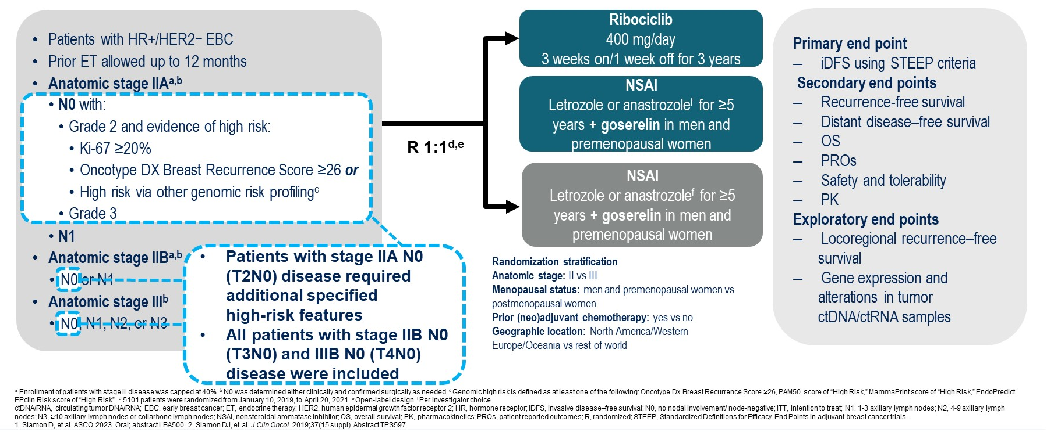
Phase III NATALEE: Study Design
Yardley DA et al. ASCO 2024;Abstract 512

Slide 43
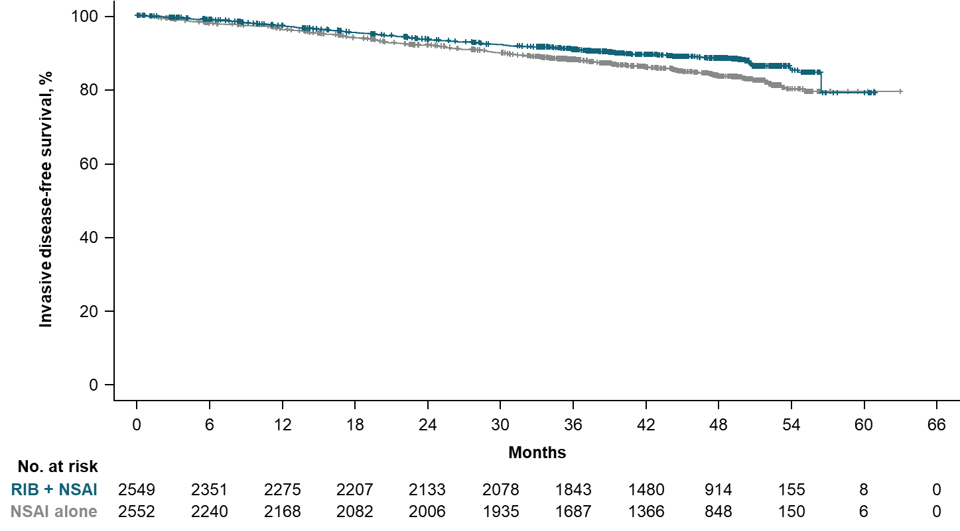
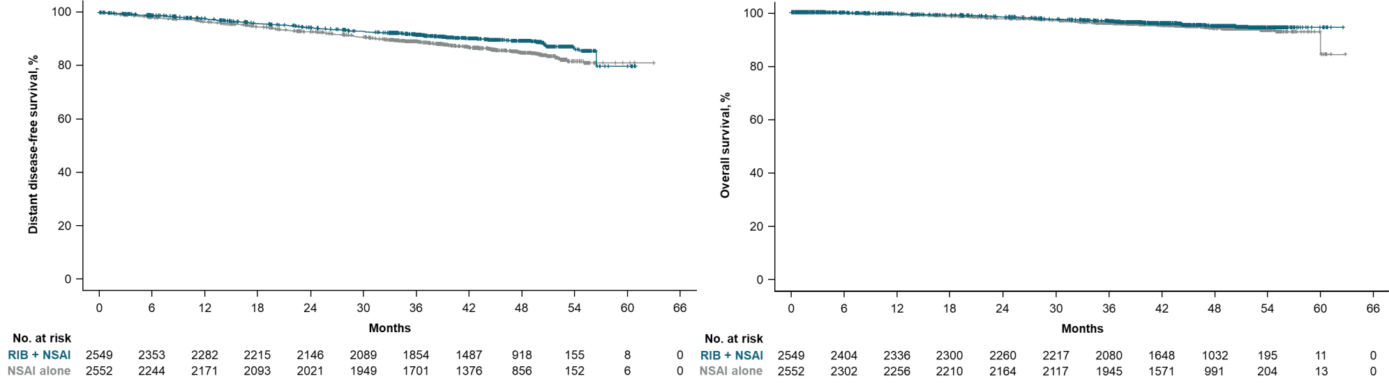
NATALEE STUDY: iDFS, DDFS & OS outcomes with RIB+NSAI after planned 3-year treatment
Ribociclib
iDFS
 | RIB + NSAI | NSAI alone
Events/n (%) | 263/2549 (10.3) | 340/2552 (13.3)
Hazard ratio (95% CI) | 0.715 (0.609-0.840)
Nominal 1-sided P value | <0.0001
88.5%
83.6%
∆4.9%
3 weeks on/1 week off for 3 years
+
NSAI
Letrozole or anastrozole^{d} for ≥5 years
+ goserelin in men and
premenopausal women
90.8%
88.1%
∆2.7%
Adult patients with HR+/HER2− EBC
Prior ET allowed ≤12 mo prior to randomization
Anatomical stage IIAª
Anatomical stage IIBª
Anatomical stage III
N = 5101^{b}
R 1:1^{c}
NSAI
Letrozole or anastrozole^{d} for ≥5 years
+ goserelin in men and premenopausal women
DDFS
OS
Median follow-up for DDFS, 44.2 mo
Median follow-up for OS, 44.3 mo
 | RIB + NSAI | NSAI alone
Events/n (%) | 240/2549 (9.4) | 311/2552 (12.2)
Hazard ratio (95% CI) | 0.715 (0.604-0.847)
Nominal P value | <0.0001
 | RIB + NSAI | NSAI alone
Events/n (%) | 105/2549 (4.1) | 121/2552 (4.7)
Hazard ratio (95% CI) | 0.827 (0.636-1.074)
Nominal P value | 0.0766
Peter A. Fasching ESMO 2024;Abstract LBA13

Slide 44
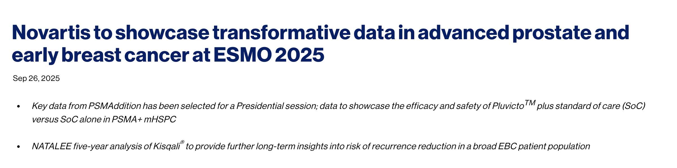
Manufacturer to showcase
Key data from PSMAddition has been selected for a Presidential session; data to showcase the efficacy and safety of ¹⁷⁷Lu plus standard of care (SoC) versus SoC alone in PSMA + mHSPC
¹⁷⁷Lu
ribociclib to provide
https://www.novartis.com/news/media-releases/novartis-showcase-transformative-data-advanced-prostate-and-early-breast-cancer-esmo-2025

Slide 45
Evolving Hormonal Treatment Landscape of HR+ Advanced MBC
Targeted Therapy + ET
Tamoxifen
(selective ER modulator)
Fulvestrant
(selective ER
degrader)
Everolimus
(mTOR inhibitor)
Ribociclib
Abemaciclib
(CDK4/6 inhibitors)
Elacestrant
(Oral SERD)
Inavolisib
(PI3Kα inhibitor)
AIs
Anastrozole
Exemestane
Letrozole
Fulvestrant HD
Palbociclib
(CDK4/6 inhibitor)
Alpelisib
(PI3Kα inhibitor)
Capivasertib
(AKT inhibitor)
1970-80
1990s
2002
2010
2012
2015-17
2017-18
2019
2022
2023
2024
FDA Approval
Notes:
AI, aromatase inhibitor; ET, endocrine therapy; HR, hormone receptor; MBC, metastatic breast cancer; SoC, standard of care; tx, therapy.

Slide 46
First-Line Metastatic Trials with CDK4/6 Inhibitors
Trial | N | CDK4/6i | Endocrine Therapy | Phase | Median PFS, mo | Median OS, mo
PALOMA-1 | 165 | Palbociclib (P) | Letrozole (L) | 2 | 10.2 (L) vs 20.2 (L+P) HR = 0.49 P = .0004 | 34.5 (L) vs 37.5 (P+L) HR = 0.897 P =.28
PALOMA-2 | 666 | Palbociclib (P) | Letrozole (L) | 3 | 14.5 (L) vs 24.8 (L+P) HR = 0.58 P < .001 | 51.2 (L) vs 53.9 (P+L) HR = 0.96 P = .34
MONARCH 3 | 493 | Abemaciclib (A) | NSAI | 3 | 14.8 (A) vs 28.2 (ET+A) HR = 0.54 P = .000002 | 53.7 (AI) vs 66.8 (AI + A) HR = 0.804; 95% CI, 0.637-1.015 P = .067
MONALEESA-2 | 668 | Ribociclib (R) | Letrozole (L) | 3 | 16.0 (L) vs 25.3 (L+R) HR = 0.568 | 51.4 (L) Vs 63.9 (R+L) HR = 0.76; 95% CI, 0.63-0.93 P = .008
MONALEESA-7 | 672 | Ribociclib (R) | ET (Tam or AI) + OFS | 3 | 13.0 (ET) vs 23.8 (R+ET) HR = 0.55 P < .0001 | 48.0 (ET) vs 58.7 (ET+Rib) HR: 0.76; 95% CI, 0.61–0.96
Finn. Lancet Oncol. 2014. Slamon J. Clin Oncol. 2024. Goetz. Ann Oncol. 2024. Hortobagyi. N Engl J Med. 2022. Lu. Clin Canc Res. 2022.
Finn RS et al. ASCO 2017;Abstract 1001

Slide 47
Summary of updated CDK 4/6i data
In the adjuvant setting, the addition of abemaciclib and ribociclib to standard of care ET improves DFS
OS data to be presented at ESMO (abemaciclib)
In the metastatic setting, CDK 4/6 inhibitors (ribociclib and abemaciclib) in combination with ET improve survival in the first- and second-line settings.
No head-to-head trials comparing palbociclib, ribociclib and abemaciclib

Slide 48
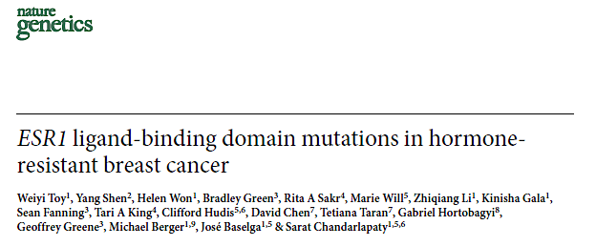
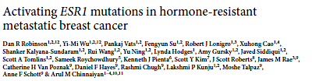
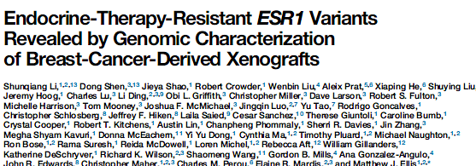
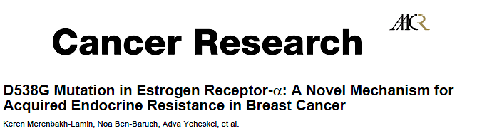
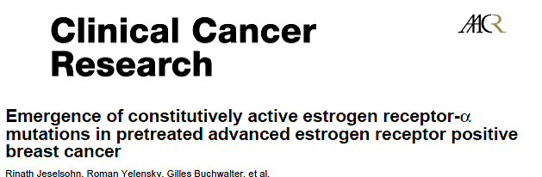
ESR1 Mutations: Therapeutic Implications

Slide 49
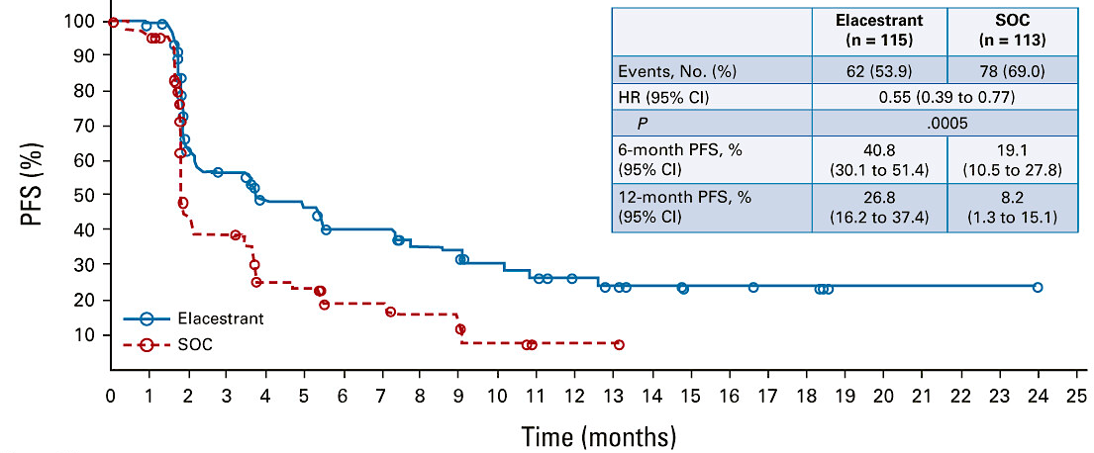
Phase III EMERALD: Elacestrant vs SOC in ESR1m Tumors
Based on these data, the FDA approved elacestrant for ER-positive, HER2-negative,
ESR1-mutated advanced or metastatic breast cancer
(January 7, 2023)
Bidard FC et al. J Clin Oncol. 2022 Oct 1;40(28):3246-3256.

Slide 50
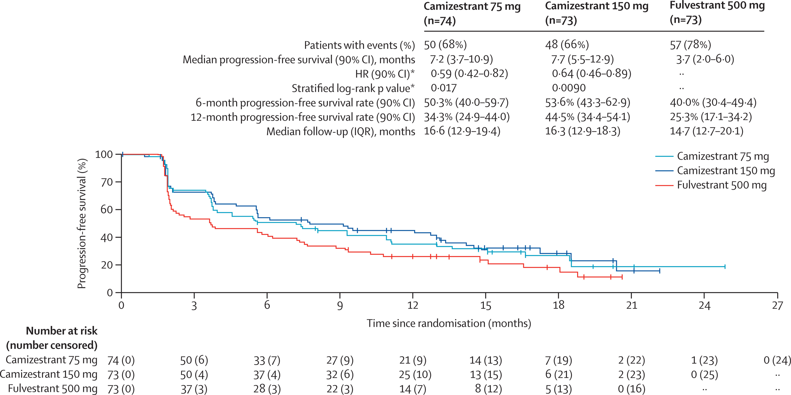
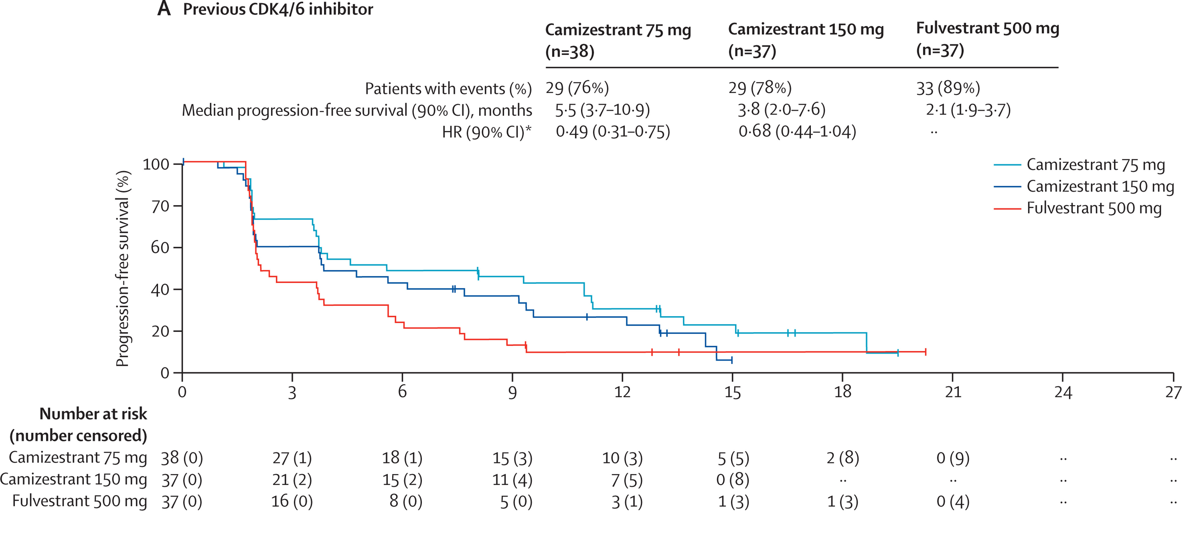
Camizestrant versus Fulvestrant in Post-menopausal Women with Estrogen receptor-positive, HER2-negative Advanced Breast Cancer (SERENA-2)
All Patients
Previous CDK 4/6 Inhibitors
Oliveira et al. Lancet Oncology 2025

Slide 51
(Secondary) Prevention
“…, prevention is so much better than healing because it saves the labour
of being sick.”
Thomas Adams
ca. 1618
Quoted in Muir CS. Cancer Res 1990;50:6441-8.

Slide 52
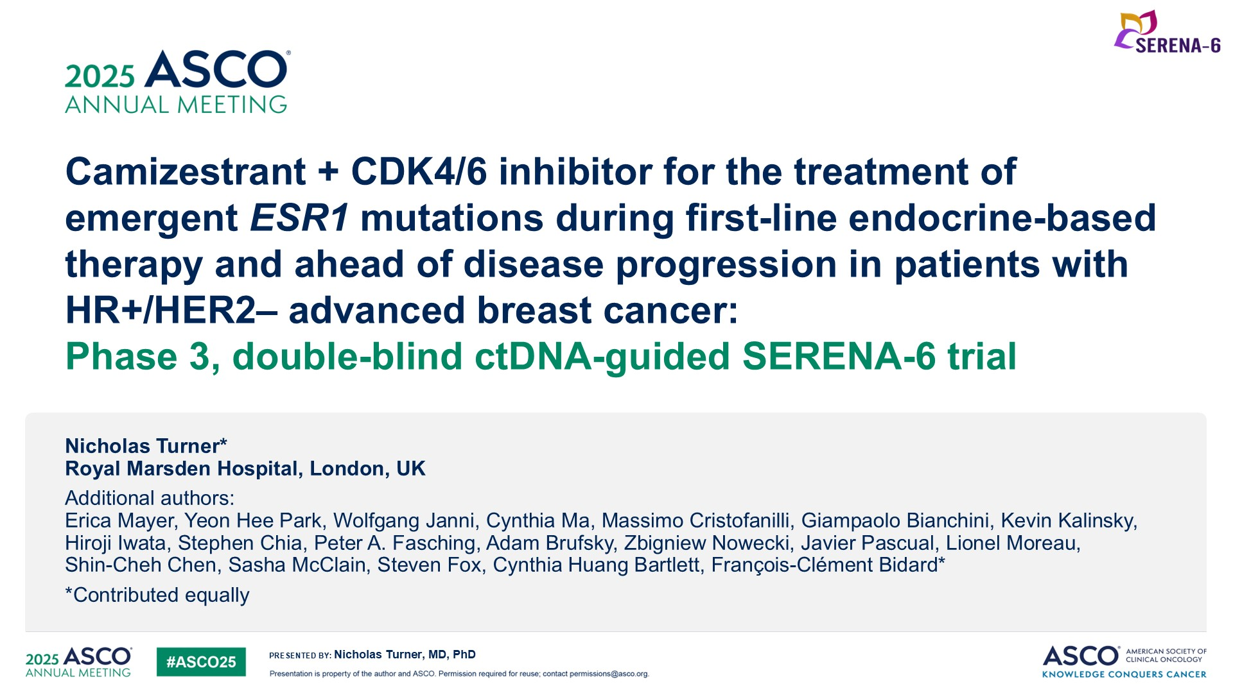
Camizestrant + CDK4/6 inhibitor for the treatment of emergent ESR1 mutations during first-line endocrine-based therapy and ahead of disease progression in patients with HR+/HER2– advanced breast cancer: <br />Phase 3, double-blind ctDNA-guided SERENA-6 trial
Abstract LBA4

Slide 53
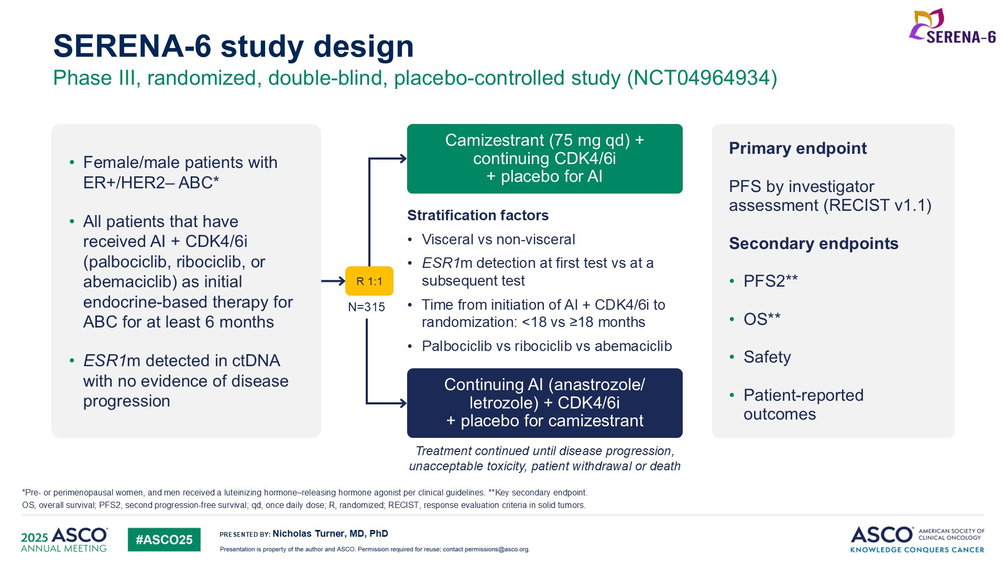
SERENA-6 study design
Abstract LBA4

Slide 54
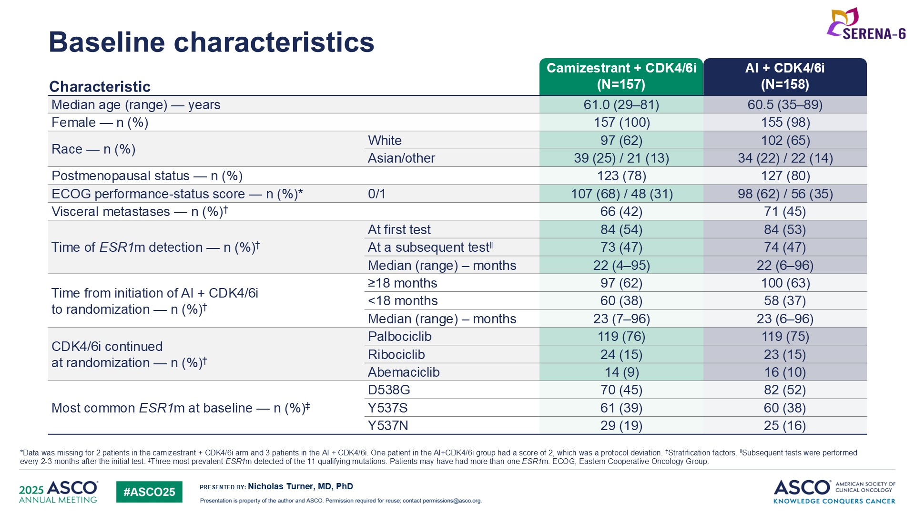
Baseline characteristics
Abstract LBA4

Slide 55
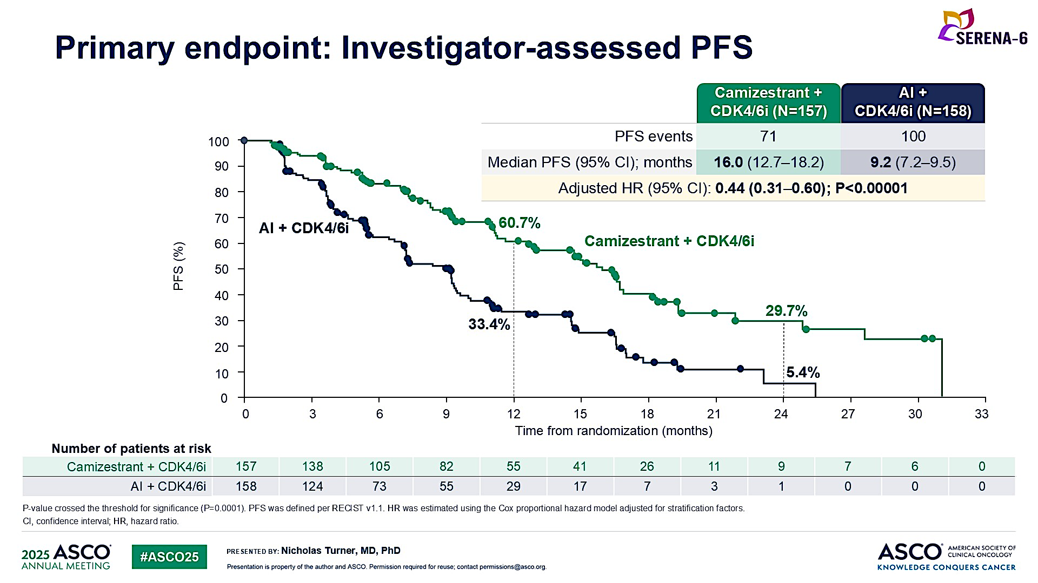
Primary endpoint: Investigator-assessed PFS
Abstract LBA4

Slide 56
Concerns regarding SERENA-6 Design
The study design is testing:
new treatment strategy (ie molecular vs anatomical progression) and
a novel drug (Camizestrant)
both only being in the experimental arm
There is no crossover to determine which strategy results in better overall survival
Question: Is there evidence that treating patients early (at the time of MRD relapse) prevents symptomatic progression of disease?
Can’t test a new strategy for treatment AND a novel drug
both of which are only in the experimental arm
and claim both a better strategy and a more efficacious therapy
while never showing an overall survival benefit

Slide 57
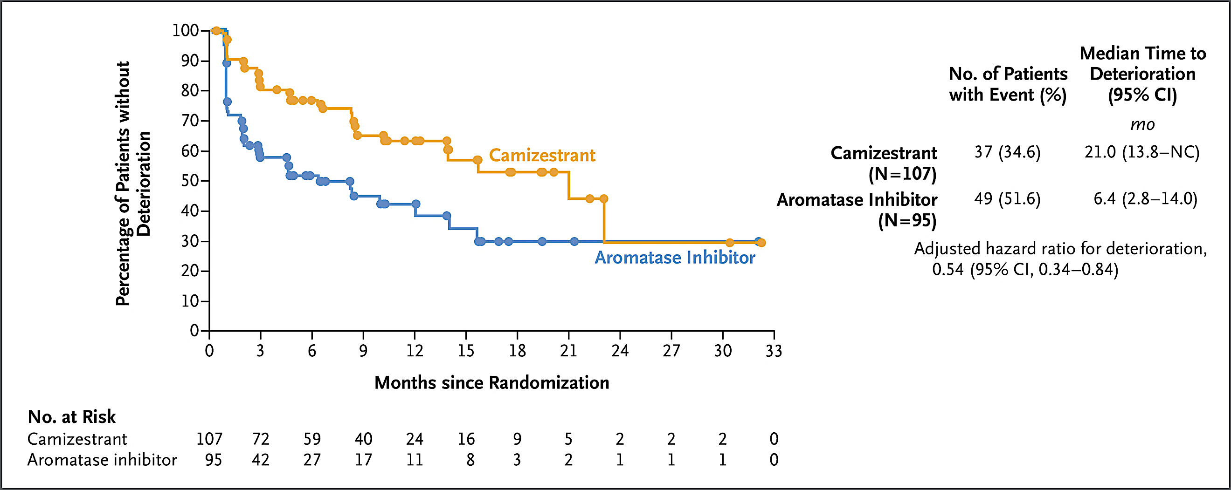
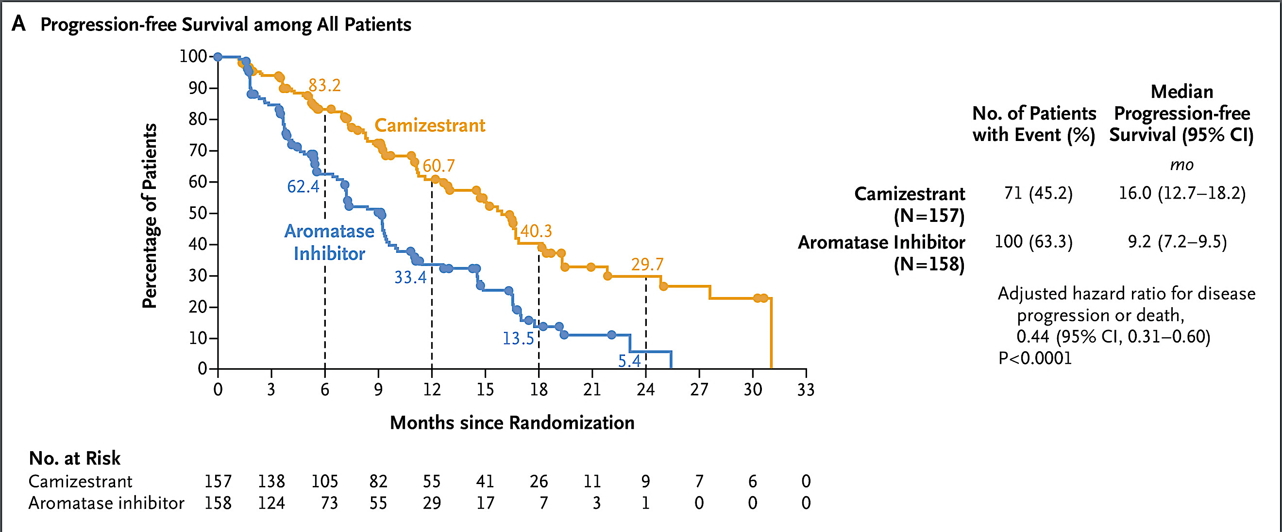
Time until Deterioration in Global Health Status and Quality of Life versus PFS: Disconnect between PFS and QOL Deterioration
Bidard et al. NEJM 2025

Slide 58
Summary
ESR1 mutations are a common mechanism of acquired resistance in the setting of aromatase inhibitors (+/- CDK4/6i)
Oral SERDS: Limited antitumor activity in the post-CDK4/6i setting
Greater antitumor activity in patients with ESR1 mutations and prior endocrine sensitivity
SERENA-6: Value of switching from an AI to oral SERDS in the 1st line treatment of ER+ MBC with molecular progression (without radiographic progression)
Overall Survival: Unclear given the lack of crossover of the control treatment to camizestrant
Quality of Life: Need more information

Slide 59
Data + Perspectives: Clinical Investigators Explore the Application of Recent Datasets in Current Oncology Care CME/MOC, NCPD and ACPE Accredited
Saturday, October 11, 2025 7:15 AM – 12:30 PM ET

Slide 60
monarchE: Primary Overall Survival (OS) Results of Adjuvant Abemaciclib + Endocrine Therapy (ET) for HR+, HER2-, High-Risk Early Breast Cancer (EBC)
Johnston SR et al.
ESMO 2025;Abstract LBA13.
PROFFERED PAPER | SUNDAY, OCTOBER 19 | 14:50 CEST

Slide 61
Questions from General Medical Oncologists
Oncotype DX or MammaPrint — how do you choose which one to use? Do you ever order both?
Is there data with Oncotype DX to support treatment de-escalation such as dropping the anthracycline or reducing to 4 cycles of TC?
Do you use Oncotype DX in the neoadjuvant setting? Would you use it for a tumor less than 0.5 cm? What about an isolated local recurrence?

Slide 62
Questions from General Medical Oncologists
Case: Initial treatment for ILC >5 cm and >3 LNs on MRI? Mastectomy/ALD or neoadjuvant chemo or check Oncotype or MammaPrint/BluePrint and then decide on neoadjuvant endocrine therapy vs chemo?

Slide 63
Questions from General Medical Oncologists
Do you use CDK4/6 inhibitors in the neoadjuvant setting?
Can CDK4/6i be used to downstage HR-positive cancers for surgery if patients are nonresponsive to chemotherapy?

Slide 64
Questions from General Medical Oncologists
How would you approach first-line therapy for a patient with HR-positive, HER2-negative mBC in visceral crisis: CDK4/6i with endocrine therapy or chemotherapy or chemoendocrine therapy?

Slide 65
Questions from General Medical Oncologists
What is your preferred adjuvant CDK4/6i for a node-positive patient?
When using ribociclib in the adjuvant setting, are you generally continuing for 3 years?
When using adjuvant CDK4/6i, are you always following the indication, ie, would you use abema in a node-negative patient?

Slide 66
Questions from General Medical Oncologists
Is there a current role for ctDNA in breast cancer?

Slide 67
Relapsed/Refractory Hormone Receptor-Positive Metastatic Breast Cancer
Rita Nanda, M.D.
Research To Practice CME Symposium
Orlando, Florida
October 11, 2025

Slide 68
2L Therapy post PD
Molecularly Driven Recommendations

Slide 69
Targeted Therapies in 2L+ Setting
Agents targeting PI3K and AKT pathway

Slide 70
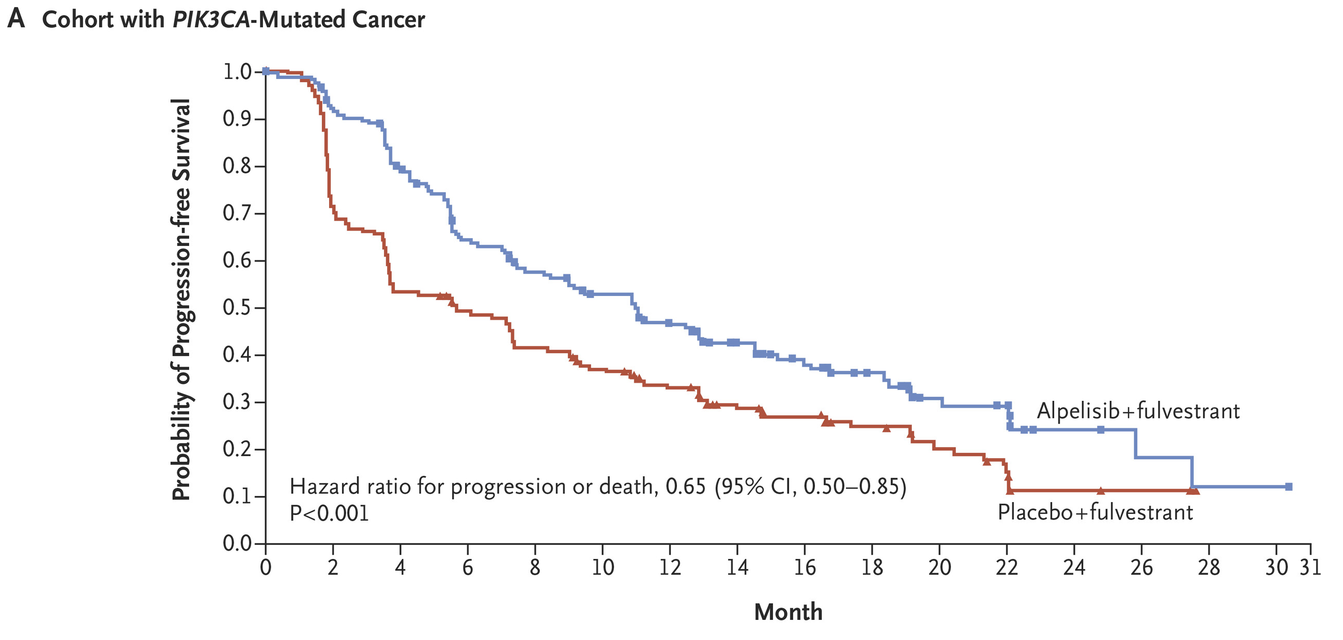
SOLAR-1 Trial - PIK3CA-mutated HR+/HER2- mBC Phase 3 RCT of Fulvestrant + Alpelisib/Placebo in unselected
PIK3CA mutations occur in about 40% of HR+/HER2- breast cancers
Alpelisib is α-selective PI3Ki
Key characteristics:
HgbA1c < 6.4% allowed
Lung or liver mets 50%
1st line 52%; 2nd line 46%
Prior CDK4/6i 6%
mPFS: 11.0 vs 5.7 mos
▲ 5.3 mos
Key toxicities with alpelisib:
Hyperglycemia (G3/4 36%)
Rash (G3/4 10%)
Diarrhea (G3/4 7%)
BYLieve P2 Trial (all had PD post CDK4/6i): Similar Activity
André F et al. N Engl J Med. 2019;380(20):1929-1940.
Ciruelos. SABCS 2020. Abstr PD2-06.
Rugo et al. ASCO 2020 and SABCS 2020

Slide 71


CAPItello-291: P3 RCT Fulvestrant + Capivasertib/Placebo
Key Eligibility: (N=708)
ER+/HER2- ABC (postmeno women)
Recurrence on or < 12 mos from end of AI
≤ 2 lines prior ET for ABC
≤ 1 line of chemo for ABC
Prior CDK4/6i allowed (≥ 51% required)
No prior SERD or PI3K/AKT/mTORi
HgbA1c < 8.0%
Key Characteristics:
Prior CDK4/6i: 69%
Prior ET for ABC: 89%
Prior chemo for ABC: 18%
AKT pathway alterations: ~41%
HgbA1c < 8% allowed
Fulvestrant + Capivasertib
R
Fulvestrant + Placebo
Overall population
7.2 vs 3.6 mos
▲3.6 mos
Similar benefit seen in those with alterations in PIK3CA, AKT1, or PTEN
Oliveira M et al. SABCS 2022; GS3-04; Turner et al NEJM 2023;388:2058

Slide 72

CAPItello-291: Progression-Free Survival (PFS) in the AKT Pathway-Altered Population
Turner N et al. San Antonio Breast Cancer Symposium 2022;Abstract GS3-04.

Slide 73

CAPItello-291: Safety Profile
Turner N et al. San Antonio Breast Cancer Symposium 2022;Abstract GS3-04.

Slide 74
VIKTORIA-1: P3 RCT Gedatolisib pan-PI3K and mTORC1/2i PRESS RELEASE
Key Eligibility:
ER+/HER2- ABC
Confirmed PIK3CA mutation status
≤ 2 lines prior ET for ABC
No chemo for ABC
Prior CDK4/6i + AI
No prior AKT, PI3K, mTORi
Gedatolisib + Palbociclib + Fulvestrant
R
Gedatolisib + Fulvestrant
Fulvestrant
Two cohorts PIK3CAwt (n=351) and PIK3CAm (n=350)
Gedatolisib triplet:
mPFS (BICR) 9.3 mo triplet vs 2.0 mo fulv alone (HR, 0.24; 95% CI, 0.17–0.35; P <.0001).
Gedatolisib doublet:
mPFS (BICR) 7.4 mo doublet vs 2.0 mo fulv alone (HR, 0.33; 95% CI, 0.24–0.48; P <.0001).

Slide 75
Targeted Therapies in 2L+ Setting
Agents targeting ESR1

Slide 76
EMERALD Open Label P3RCT – Elacestrant vs SOC ET
Postmeno women and men with ER+/HER2- ABC or mBC
≤1 lines prior chemo for mBC
1 to 2 lines of ET
Documented PD on CDK4/6 inhibitor
Measurable disease or bone-only disease eligible
Elacestrant 400 mg PO QD
Strat factors
ESR1 status (by ctDNA)
Prior fulvestrant
Visceral disease
Key Characteristics:
Visceral mets: ~70%
Prior CDK4/6i: 100%
Prior ET: 2 lines ~46%
Prior chemo: 1 line 20%
N = 466
R
Endocrine therapy*
* SOC ET: 69% received fulvestrant
ESR1m
Clinically significant benefit if ET sensitive disease, based on PFS duration on prior CDK4/6i:
> 6 mos: mPFS 4.1 vs 1.9 mos (HR 0.52,.36-.74)
> 12 mos: mPFS 8.6 vs 1.9 mos (HR 0.41,.26-.63)
> 18 mos: mPFS 8.6 vs 2.1 mos (HR 0.47,.27-.79)
mPFS 3.78 vs 1.87 mos
HR 0.50 (95% CI 0.34-0.74), p=0.0005
Bidard FC et al JCO 2022

Slide 77

Elacestrant for Patients with PIK3CA-Mutated Disease
ET = endocrine therapy; SOC = standard of care
Bardia A et al. Clin Cancer Res 2024 October 1;30(19):4299-309.

Slide 78

Elacestrant After ≥12 Months of ET and CDK4/6 Inhibition
mPFS = median progression-free survival
Bardia A et al. Clin Cancer Res 2024 October 1;30(19):4299-309.

Slide 79


EMBER-3 Trial: Open Label P3RCT
Key Characteristics
SOC ET: 88% Fulvestrant; 10% Exemestane
~35% ESR1m
40% PI3K pathway alterations
~60% prior CDK4/6i
FDA Approval for ESR1m 9/25/25
Jhaveri K, et al. NEJM 2025;392:12.

Slide 80

EMBER-3 Study Imlunestrant + Abema vs Imlunestrant Alone
PFS Imlu + Abema vs Imlu Alone: Overall population
mPFS 9.4 vs 5.5 mos (▲3.9 mos)
HR = 0.57 (.44-.73)
Imlunestrant-Abemaciclib
PFS Imlu + Abema vs Imlu Alone: Prior CDK4/6i
mPFS 9.1 vs 3.7 mos (▲5.4 mos)
HR = 0.51 (.38-.68)
Benefit of Imlunestrant + Abema regardless of ESR1m status, PI3Km, and prior CDK4/6i use
Jhaveri K, et al. NEJM 2025;392:12.

Slide 81

EMBER-3: PFS with Imlunestrant and Abemaciclib by ESR1m Status
Jhaveri KL et al. San Antonio Breast Cancer Symposium 2024;Abstract GS1-01.

Slide 82

Imlunestrant and Abemaciclib for PIK3CA-Mutated Disease
Jhaveri KL et al. San Antonio Breast Cancer Symposium 2024;Abstract GS1-01.

Slide 83
FDA Approves Imlunestrant for Adults with ER-Positive, HER2-Negative, ESR1-Mutated Advanced or Metastatic Breast Cancer Press Release: September 25, 2025
“The FDA has approved imlunestrant, an oral estrogen receptor antagonist, for the treatment of adults with estrogen receptor-positive (ER+), human epidermal growth factor receptor 2-negative (HER2–), ESR1-mutated advanced or metastatic breast cancer (MBC) whose disease progressed after at least one line of endocrine therapy (ET).
In the Phase 3 EMBER-3 trial, imlunestrant reduced the risk of progression or death by 38% versus ET. Among patients with ESR1-mutated MBC, imlunestrant significantly improved progression-free survival (PFS) versus fulvestrant or exemestane, with a median PFS of 5.5 months vs 3.8 months (HR = 0.62 [95% CI: 0.46-0.82]); p-value = 0.0008.”
https://investor.lilly.com/news-releases/news-release-details/us-fda-approves-inluriyo-imlunestrant-adults-er-her2-esr1

Slide 84


VERITAC-2: Open Label P3RCT
Key Characteristics
Visceral mets ~63%
~43% ESR1m
100% prior CDK4/6i
~ 80% 1 prior/~20% 2 prior LOT
mPFS 5.0 vs 2.1 mos (▲2.9 mos)
HR = 0.58 (0.43-0.78); p<0.001
Campone M, et al. NEJM 2025;393:556-68.

Slide 85
Antibody-Drug Conjugates

Slide 86


DESTINY Breast-04: P3 RCT T-DXd vs TPC in HER2-low mBC after 1-2 prior L Chemo for mBC
T-DXd
Key Eligibility:
- HER2- mBC
- 1-2L prior chemo for mBC
TPC
N=540 (HR+ 480)
TPC: cape, eribulin, gem, paclitaxel, or nab pac
PROGRESSION FREE SURVIVAL
OVERALL SURVIVAL
▲6.4 mos
Modi S, et al. ASCO 2022. Abstract LBA3, Modi et al. NEJM 2022.

Slide 87

DESTINY Breast-06: P3 RCT T-DXd vs TPC in HER2-low/ultralow mBC in Chemo-naïve
Key Eligibility:
HR+/HER2 lo/ultralo* mBC
Chemo naïve for mBC
> 2L ET for mBC or 1L ET if endo-resistant
T-DXd
TPC
N=866
TPC: cape, paclitaxel, or nab pac
Similar PFS benefit seen in HER2 ultralow
OS data immature – 12 mos OS in HER2-low 87.6% vs 81.7% (NS)
Key Characteristics:
HER2-low 82%
De novo mBC ~31%
Visceral ~85%
1º ET resistance ~31%
*HER2 low: IHC 1+, 2+ (ISH neg); HER2 ultralow: IHC 0 with any membrane staining
Curigliano et al. ASCO 2024;Absract LBA1000. Bardia et al. NEJM 2024;2110-22

Slide 88

DESTINY Breast-06: P3 RCT T-DXd vs TPC in HER2-low/ultralow mBC in Chemo-naïve
Key Eligibility:
HR+/HER2 lo/ultralo* mBC
Chemo naïve for mBC
> 2L ET for mBC or 1L ET if endo-resistant
T-DXd
TPC
N=866
TPC: cape, paclitaxel, or nab pac
Similar PFS benefit seen in HER2 ultralow
OS data immature – 12 mos OS in HER2-low 87.6% vs 81.7% (NS)
ILD all grade 11.3%
G3/4: 0.7% (n=3)
G5: 0.7% (n=3)
Key Characteristics:
HER2-low 82%
De novo mBC ~31%
Visceral ~85%
1º ET resistance ~31%
*HER2 low: IHC 1+, 2+ (ISH neg); HER2 ultralow: IHC 0 with any membrane staining
Curigliano et al. ASCO 2024;Absract LBA1000. Bardia et al. NEJM 2024;2110-22

Slide 89

Bardia A et al. San Antonio Breast Cancer Symposium 2024;Abstract LB1-04

Slide 90


TROPICS-02: P3 RCT Sacituzumab Govitecan vs TPC in HR+/HER2- mBC
Key Eligibility:
- HER2- mBC
- 2-4L prior chemo for mBC
Sacituzumab Govitecan
TPC
N=543
PFS¹
OS²
Median F/U: 10.2 mos
Median F/U: 12.5 mos
BICR analysis | SG (n=272) | TPC (n=271)
Median PFS, mo (95% CI) | 5.5 (4.2–7.0) | 4.0 (3.1–4.4)
Stratified HR (95% CI) | 0.66 (0.53–0.83)
Stratified Log Rank P value | P=0.0003
 | SG (n=272) | TPC (n=271)
Median OS, mo (95% CI) | 14.4 (13.0–15.7) | 11.2 (10.1–12.7)
Stratified HR (95% CI) | 0.79 (0.65–0.96)
Stratified Log Rank P value | P=0.020
▲1.5 mos
▲3.2 mos
12 months
PFS rate, % (95% CI)
 | SG (n=272) | TPC (n=271)
6-mo | 46.1 (39.4–52.6) | 30.3 (23.6–37.3)
9-mo | 32.5 (25.9–39.2) | 17.3 (11.5–24.2)
12-mo | 21.3 (15.2–28.1) | 7.1 (2.8–13.9)
12 months
OS rate, % (95% CI)
 | SG (n=272) | TPC (n=271)
12-mo | 61 (55–66) | 47 (41–53)
9 months
6 months
1. Rugo HS, et al. J Clin Oncol. 2022;40:3365-3376; 2. Rugo H, et al. ESMO 2022. Oral LBA76.

Slide 91

Phase III TROPiCS-02: Safety Summary
TEAEs = treatment-emergent adverse events; SG = sacituzumab govitecan, TPC = treatment of physician's choice
Tolaney S et al. ASCO 2023;Abstract 1003.

Slide 92


TROPION-Breast01: P3 RCT Dato-DXd vs Chemo in HR+/HER2– MBC
Key Eligibility Criteria
HR+/HER2– MBC (HER2 IHC 0/1+/2+; ISH–)
Progressed on and not suitable for ET
1-2 prior lines of Chemo in inoperable/metastatic setting
ECOG PS 0-1
mPFS 6.9 vs 4.9 mos
▲2 mos
HR 0.63 (.52-.76)
RANDOMIZED
Dato-DXd
6 mg/kg IV day 1 q3w
n=365
N=732
1:1
ICCª
Eribulin D1, 8 q3w; vinorelbine D1, 8 q3w;
gemcitabine D1, 8 q3w; capecitabine D1-14 q3w
n=367
Dual primary endpoints: PFS by BICR per RECIST v1.1, OS
Secondary endpoints: ORR, PFS by investigator, TFST, safety, PROs
Similar findings in those with prior CDK4/6i ≤ 12 mos vs > 12 mos
Any grade stomatitis seen in 50% on Dato-DXd (6% G3) – 0.3% D/C rate due to stomatitis
ª Investigator’s choice of Chemo (ICC): eribulin, 1.4 mg/kg IV on D1, 8, q3w; vinorelbine, 25 mg/m² IV on D1, 8, q3w; gemcitabine 1000 mg/m² IV on D1, 8, q3w; capecitabine 1000 or 1250 mg/m² (dose per standard institutional practice BID D1-14, q3w.
Pernas S, et al. ASCO 2024. Abstract 1006
Bardia A et al. JCO 2024;43:285-96.

Slide 93

Phase III TROPION-Breast01: Overall Survival (OS)
Dato-DXd = datopotamab deruxtecan; ICC = investigator's choice of chemotherapy
Pistilli B et al. ESMO Virtual Plenary 2025;Abstract VP1-2025.

Slide 94

Phase III TROPION-Breast01: Safety Profile
TRAEs = treatment-related adverse events; ILD = interstitial lung disease
Bardia A et al. ESMO 2023;Abstract LBA11.

Slide 95
FDA Approves Datopotamab Deruxtecan-dlnk for Unresectable or Metastatic HR-Positive, HER2-Negative Breast Cancer Press Release: January 17, 2025
“On January 17, 2025, the Food and Drug Administration approved datopotamab deruxtecan-dlnk, a Trop-2-directed antibody and topoisomerase inhibitor conjugate, for adult patients with unresectable or metastatic, hormone receptor (HR)-positive, human epidermal growth factor receptor 2 (HER2)-negative (IHC 0, IHC1+ or IHC2+/ISH-) breast cancer who have received prior endocrine-based therapy and chemotherapy for unresectable or metastatic disease.
Efficacy was evaluated in TROPION-Breast01 (NCT05104866), a multicenter, open-label, randomized trial. Patients must have experienced disease progression, been deemed unsuitable for further endocrine therapy, and have received one or two lines of prior chemotherapy for unresectable or metastatic disease. Patients were excluded for a history of ILD/pneumonitis requiring steroids, ongoing ILD/pneumonitis, clinically active brain metastases, or clinically significant corneal disease. Patients also were excluded for ECOG performance status >1.”
https://www.fda.gov/drugs/resources-information-approved-drugs/fda-approves-datopotamab-deruxtecan-dlnk-unresectable-or-metastatic-hr-positive-her2-negative-breast

Slide 96
Data + Perspectives: Clinical Investigators Explore the Application of Recent Datasets in Current Oncology Care CME/MOC, NCPD and ACPE Accredited
Saturday, October 11, 2025 7:15 AM – 12:30 PM ET

Slide 97




A 65-year-old woman (PS 0) with ER-positive, HER2-negative (IHC 0/null) de novo mBC receives ribociclib + letrozole for 2.5 years followed by disease progression with multiple minimally symptomatic bone metastases
ESR1 mutation
PIK3CA mutation
Elacestrant
12
Capivasertib + fulvestrant
6
Everolimus + fulvestrant
1
Inavolisib + palbociclib + fulvestrant
1

Slide 98


An 80-year-old woman (PS 1) with ER-positive, HER2-negative (IHC 0/null) de novo mBC receives ribociclib + letrozole for 2.5 years followed by disease progression with multiple minimally symptomatic bone metastases
ESR1 mutation
PIK3CA mutation
Elacestrant
15
Capivasertib + fulvestrant
3
Fulvestrant
1
Inavolisib + palbociclib + fulvestrant
1

Slide 99


A 65-year-old woman (PS 0) with ER-positive, HER2-negative (IHC 0/null) de novo mBC receives ribociclib + letrozole for 10 months followed by disease progression with multiple minimally symptomatic bone metastases
ESR1 mutation
PIK3CA mutation
17
Capivasertib + fulvestrant
Elacestrant
2
Everolimus + fulvestrant
1

Slide 100





A 65-year-old woman (PS 0) with ER-positive, HER2-negative (IHC 0/null) de novo mBC receives ribociclib + letrozole for 2.5 years followed by disease progression with multiple symptomatic visceral metastases and normal LFTs
ESR1 mutation
PIK3CA mutation
Capivasertib + fulvestrant
10
Elacestrant
3
Capecitabine
3
Everolimus + fulvestrant
2
Abemaciclib + fulvestrant
1
Inavolisib + palbociclib + fulvestrant
1

Slide 101

If imlunestrant were available, in which situations, if any, would you use this agent as monotherapy?
17
I would consider it a clinically equivalent option whenever elacestrant is currently employed
It would be my preferred option whenever elacestrant is currently employed
3
Regulatory and reimbursement issues aside, are there situations in which you would employ the combination of imlunestrant/abemaciclib for ER-positive, HER2-negative mBC?
20
Yes

Slide 102


Regulatory and reimbursement issues aside, do you believe that the results from the SERENA-6 study justify the routine use of serial ctDNA monitoring for early detection of ESR1 mutations in patients with ER-positive, HER2-negative mBC receiving first-line therapy?
Clinical Investigators
Yes
7
No
13
General Medical Oncologists
Survey of 20 US-based clinical investigators and 50 general medical oncologists

Slide 103
Questions from General Medical Oncologists
What would you recommend as second-line treatment for a patient with both ESR1 and PIK3CA mutations?

Slide 104
Questions from General Medical Oncologists
Where does the combination of imlunestrant and abemaciclib fit in?

Slide 105
Questions from General Medical Oncologists
What is the current role of alpelisib?
Would you use the inavolisib triplet for de novo mBC?
What do you typically recommend as second-line treatment after progression on the first-line inavolisib triplet? Is rebiopsy necessary?

Slide 106
Questions from General Medical Oncologists
Case: 62-year-old woman with HR-positive, HER2-negative mBC whose disease progressed after 2 years on an AI + CDK4/6 inhibitor therapy. Bone and nodal mets, minimal symptoms. ESR1 and PIK3CA mutations. She has no diabetes but does have mild hepatic steatosis. HBA1C 6.8

Slide 107
Questions from General Medical Oncologists
Can we sequence TROP2 ADC after TROP2 ADC?
How do you choose between TROP2 ADC and HER2 ADC in patients eligible for both? Does biomarker profile really matter?
Which do you typically use — sacituzumab govitecan or Dato-DXd?

Slide 108
Questions from General Medical Oncologists
How would you compare the toxicities and quality of life with sacituzumab govitecan versus Dato-DXd?
How big of a concern are the ocular side effects of Dato-DXd? What about mucositis? How do you attempt to prevent and manage these toxicities?

Slide 109
Questions from General Medical Oncologists
Are there situations in which it’s safe to rechallenge with T-DXd after pneumonitis?
How do you manage CDK4/6 inhibitor-associated ILD?
Can T-DXd be used for a patient with decompensated heart failure — EF 35%?
Should T-DXd be administered to patients with HR-negative, HER2-ultralow disease?

Slide 110
Management of HER2-Positive Breast Cancer
Harold J Burstein, MD, PhD
Director of Academic Partnerships
Institute Physician
Dana-Farber Cancer Institute
Professor of Medicine
Harvard Medical School
Boston, Massachusetts

Slide 111
pCR rates (%) with THP or TCHP
 | THP | TCHP
HELEN-006 overall | 66 | 58
ER neg | 86 | 70
ER pos | 53 | 48
neoCARHP overall | 64 | 66
ER neg | 78 | 78
ER pos | 56 | 59
EA1181 overall | 44
ER neg | 64
ER pos | 33
Key questions:
Good enough?
18 wks or 12 wks?
Heterogeneous tumors / HER2 2+ esp ER negative
Will better adjuvant salvage make this yet-less relevant?
Chen XC et al. Lancet Oncol. 2025 Jan;26(1):27-36.
Gao HF et al. ASCO 2025;Abstract LBA500
Tung NM et al. ASCO 2025;Abstract 501

Slide 112
Destiny Breast 11
Preoperative therapy for HER2+ early-stage breast cancer
Arm A. T-DXd
Arm B. T-DXd → THP
Arm C. dd AC → THP
Primary endpoint: pCR

Slide 113

T-DXd

Slide 114
Destiny Breast 11
Preoperative therapy for HER2+ early-stage breast cancer
Arm A. T-DXd X
Arm B. T-DXd → THP 
Arm C. dd AC → THP
Primary endpoint: pCR

Slide 115

KATHERINE Trial.
Geyer C, et al. N Engl J Med 2025;392:249-257

Slide 116
Destiny Breast 05
Patients with residual HER2+ breast cancer in LN after neoadjuvant chemotherapy
Arm A. T-DXd
Arm B. TDM1
Primary endpoint: iDFS

Slide 117

T-DXd

Slide 118

ExteNet: Neratinib after Trastuzumab-based adjuvant therapy
Chan A et al. Clin Breast Cancer. 2021 Feb;21(1):80-91.e7.

Slide 119



ExteNet: Neratinib after Trastuzumab-based adjuvant therapy
Holmes FA, et al. Euro J Cancer 2023;184, 48-59

Slide 120
DESTINY-Breast09 study design
A randomized, multicenter, open-label,* Phase 3 study (NCT04784715)
Eligibility criteria
HER2+ a/mBC
Asymptomatic/inactive brain mets allowed
DFI >6 mo from last chemotherapy or HER2-targeted therapy in neoadjuvant/ adjuvant setting
One prior line of ET for mBC permitted
No other prior systemic treatment for mBC†
T-DXd‡ + placebo
Endpoints
Primary
PFS (BICR)
Key secondary
OS
Secondary
PFS (INV)
ORR (BICR/INV)
DOR (BICR/INV)
PFS2 (INV)
Safety and tolerability
n=387
Blinded until final PFS analysis
T-DXd‡ + pertuzumab§
R
1:1:1
n=383
THP
Taxane (paclitaxel or docetaxel)¶ + trastuzumab║ + pertuzumab§
n=387
Stratification factors
De-novo vs recurrent mBC
HR+ or HR−
PIK3CAm (detected vs non-detected)
At this planned interim analysis (DCO Feb 26, 2025), results are reported for the T-DXd + P and THP arms
*Open label for THP arm. Double blinded for pertuzumab in experimental arms; †HER2-targeted therapy or chemotherapy; ‡5.4 mg/kg Q3W; §840 mg loading dose, then 420 mg Q3W; ¶paclitaxel 80 mg/m² QW or 175 mg/m² Q3W, or docetaxel 75 mg/m² Q3W for a minimum of six cycles or until intolerable toxicity; ║8 mg/kg loading dose, then 6 mg/kg Q3W
a/mBC, advanced/metastatic breast cancer; BICR, blinded independent central review; DCO, data cutoff; DFI, disease-free interval; DOR, duration of response; HER2, human epidermal growth factor receptor 2; HER2+, HER2-positive; HR+/−, hormone receptor–positive/–negative; INV, investigator; mBC, metastatic breast cancer; mets, metastases; mo, months; ORR, objective response rate; OS, overall survival; P, pertuzumab; PFS, progression-free survival; PFS2, second progression-free survival; PIK3CAm, phosphatidylinositol-4,5-bisphosphate 3-kinase catalytic subunit alpha mutation; Q3W, every 3 weeks; QW, once every week; R, randomization; T-DXd, trastuzumab deruxtecan
NCT04784715. Updated. May 6, 2025. Available from: https://clinicaltrials.gov/study/NCT04784715 (Accessed May 29, 2025)
Abstract LBA1008

Slide 121
DESTINY-Breast09 – 1L HER2+ mBC
Eligibility criteria
HER2+ a/mBC
Asymptomatic/inactive brain mets allowed
DFI >6 mo from last chemotherapy or HER2-targeted therapy in neoadjuvant/ adjuvant setting
One prior line of ET for mBC permitted
No other prior systemic treatment for mBC†
T-DXd‡ + placebo
Endpoints
Primary
PFS (BICR)
Key secondary
OS
Secondary
PFS (INV)
ORR (BICR/INV)
DOR (BICR/INV)
PFS2 (INV)
Safety and tolerability
n=387
Blinded until final PFS analysis
T-DXd‡ + pertuzumab§
R
1:1:1
n=383
THP
Taxane (paclitaxel or docetaxel)¶ + trastuzumab║ + pertuzumab§
n=387
→ HP
Key participant characteristics:
51% de novo mBC; 54% HR+; ~82% IHC 3+
Of those initially diagnosed with ESB: ~ 80-85% received (neo)adjuvant chemo; ~ 58% trastuzumab; ~15% pertuzumab; 2% T-DM1
Concurrent use of ET in HR+: 13.5% in T-DXd + P arm; 38.3% in THP arm
Claudine Isaacs, MD, FRCPC
Discussion of LBA1008

Slide 122
PFS (BICR): primary endpoint
 | T-DXd + P (n=383) | THP (n=387)
Median, mo (95% CI) | 40.7* (36.5, NC) | 26.9 (21.8, NC)
Hazard ratio (95% CI) | 0.56 (0.44, 0.71)
P-value | <0.00001†
1.0
93.0% (95% CI 89.9, 95.2)
85.9% (95% CI 81.9, 89.1)
T-DXd + P
mPFS: 40.7 mo† (95% CI 36.5, NC)
0.8
70.1% (95% CI 64.8, 74.8)
87.8%
(95% CI 84.0, 90.7)
0.6
72.4% (95% CI 67.4, 76.8)
Δ 13.8 mo
Probability of PFS
THP
mPFS: 26.9 mo (95% CI 21.8, NC)
0.4
52.1% (95% CI 46.4, 57.5)
Hazard ratio 0.56
95% CI 0.44, 0.71
P-value <0.00001*
Hazard ratio 0.56
95% CI 0.44, 0.71
P-value <0.00001*
0.2
0
0
3
6
9
12
15
18
21
24
27
30
33
36
39
42
45
48
Time from randomization (months)
No. at risk
T-DXd + P
383
358
355
321
293
275
242
208
175
153
82
49
21
10
3
0
387
353
312
273
241
215
187
160
124
106
51
32
12
5
1
0
THP
Statistically significant and clinically meaningful PFS benefit with T-DXd + P (median Δ 13.8 mo)
*Median PFS estimate for T-DXd + P is likely to change at updated analysis; †stratified log-rank test. A P-value of <0.00043 was required for interim analysis superiority
BICR, blinded independent central review; CI, confidence interval; mo, months; (m)PFS, (median) progression-free survival; NC, not calculable; P, pertuzumab; T-DXd, trastuzumab deruxtecan; THP, taxane + trastuzumab + pertuzumab
Abstract LBA1008

Slide 123
ORR and DOR (BICR)
Confirmed ORR*
85.1%
(95% CI 81.2, 88.5)
78.6%
(95% CI 74.1, 82.5)
15.1
(n=58)
8.5
(n=33)
 | T-DXd + P (n=383) | THP (n=387)
Median DOR, mo (95% CI) | 39.2 (35.1, NC) | 26.4 (22.3, NC)
Remaining in response at 24 mo (%) | 73.3 | 54.9
Stable disease, n (%) | 38 (9.9) | 56 (14.5)
70.0
70.0
(n=268)
(n=271)
 | CR |  | PR
 | CR |  | PR
Response rates were greater with T-DXd + P vs THP and were durable
*Based on RECIST v1.1; response required confirmation after 4 weeks BICR, blinded independent central review; CI, confidence interval; CR, complete response; DOR, duration of response; mo, months; NC, not calculable; ORR, objective response rate; P, pertuzumab; PR, partial response; RECIST, Response Evaluation Criteria in Solid Tumours; T-DXd, trastuzumab deruxtecan; THP, taxane + trastuzumab + pertuzumab
Abstract LBA1008

Slide 124
Overall survival (~16% maturity)
1.0
0.8
0.6
Probability of OS
0.4
 | T-DXd + P (n=383) | THP (n=387)
Median, mo | NC | NC
Hazard ratio (95% CI) | 0.84 (0.59, 1.19)
0.2
0
0
3
6
9
12
15
18
21
24
27
30
33
36
39
42
45
48
Time from randomization (months)
No. at risk
T-DXd + P
383
373
365
361
358
352
342
302
265
239
176
96
47
23
9
0
387
381
375
369
362
352
337
297
255
220
158
88
43
15
4
0
THP
Early OS data suggest a positive trend favoring T-DXd + P over THP
CI, confidence interval; OS, overall survival; NC, not calculable; P, pertuzumab; T-DXd, trastuzumab deruxtecan; THP, taxane + trastuzumab + pertuzumab
Abstract LBA1008

Slide 125
PFS2 (investigator assessment) and post-trial treatments
1.0
 | T-DXd + P (n=383) | THP (n=387)
Received post-discontinuation therapy in second line, n (%)† | 124 (32.4) | 181 (46.8)
Targeted therapy, n (%)† | 111 (29.0) | 166 (42.9)
T-DXd | 6 (1.6) | 39 (10.1)
T-DM1 | 7 (1.8) | 47 (12.1)
Trastuzumab-containing regimen‡ | 78 (20.4) | 51 (13.2)
Pertuzumab-containing regimen‡ | 53 (13.8) | 34 (8.8)
Chemotherapy, n (%)† | 68 (17.8) | 57 (14.7)
Docetaxel | 24 (6.3) | 8 (2.1)
Paclitaxel | 18 (4.7) | 4 (1.0)
Capecitabine | 24 (6.3) | 35 (9.0)
Endocrine therapy, n (%)† | 19 (5.0) | 13 (3.4)
0.8
0.6
Probability of PFS
 | T-DXd + P (n=383) | THP (n=387)
Data maturity | ~20% | ~30%
Median, mo (95% CI) | NC | 36.5 (36.1, NC)
Hazard ratio (95% CI) | 0.60 (0.45, 0.79)
Nominal P-value | 0.00038*
0.4
0.2
0
0
3
6
9
12
15
18
21
24
27
30
33
36
39
42
45
48
No. at risk
Time from randomization (months)
No. at risk
T-DXd + P
383
T-DXd + P
387
370
356
343
331
320
290
254
209
180
101
59
28
12
3
0
THP
THP
373
358
341
319
292
252
212
174
143
80
48
15
5
0
0
Clinically meaningful improvement in PFS2 with T-DXd + P vs THP
PFS2 was defined by investigators according to local standard clinical practice as the time from randomization to second progression (earliest progression event following first subsequent therapy) or death *Stratified log-rank test; †percentages are based on the overall population. Therapies listed are not exhaustive. Patients may have received more than one type of therapy; ‡patients may have received trastuzumab and pertuzumab concurrently
CI, confidence interval; NC, not calculable; P, pertuzumab; PFS2, second progression-free survival; T-DM1, trastuzumab emtansine; T-DXd, trastuzumab deruxtecan; THP, taxane + trastuzumab + pertuzumab
Abstract LBA1008

Slide 126
Adverse events of special interest
Adjudicated drug-related ILD/pneumonitis*
n (%) | Grade 1 | Grade 2 | Grade 3 | Grade 4 | Grade 5 | Any grade
T-DXd + P (n=381) | 17 (4.5) | 27 (7.1) | 0 | 0 | 2 (0.5) | 46 (12.1)
THP (n=382) | 2 (0.5) | 2 (0.5) | 0 | 0 | 0 | 4 (1.0)
Left ventricular dysfunction†
n (%) | Grade 1 | Grade 2 | Grade 3 | Grade 4 | Grade 5 | Any grade
T-DXd + P (n=381) | 4 (1.0) | 30 (7.9) | 7 (1.8) | 1 (0.3) | 0 | 42 (11.0)
THP (n=382) | 1 (0.3) | 19 (5.0) | 7 (1.8) | 0 | 0 | 27 (7.1)
Safety analysis set
*Adjudicated drug-related ILD/pneumonitis (grouped term) includes: chronic obstructive pulmonary disease, interstitial lung disease, organizing pneumonia, pneumonia, and pneumonitis, †left ventricular dysfunction (grouped term) includes: potential heart failure, cardiac failure, cardiac failure chronic, ejection fraction decreased, left ventricular dysfunction, and right ventricular failure
ILD, interstitial lung disease; P, pertuzumab; T-DXd, trastuzumab deruxtecan; THP, taxane + trastuzumab + pertuzumab
Abstract LBA1008

Slide 127


Incidence Increases by Line of Therapy
Using longitudinal US Flatiron Health de-identified database, 16063 MBC pts. 1955 with BM by index date
Generally, Incidence Increases Over Time; early event in ER-, HER2+
Sammons SL et al. SABCS 2023;Abstract PS11-01
Notes:
The cohort (N=16063) included pts. with BM at index date (N=947)
The CIF was run on the remaining pts without BM at index date(N=15116)
A total of 1955 patients with incident BM were recorded during the follow-up
Subtypes appear associated with different CIF, measures of association to be defined (RR, RD, HR, RMST, RMTL…)

Slide 128


T-DM1: First ADC to show HER2+ Brain Metastases Activity, KAMILLA
Phase IIIB, 2002 pts treated T-DM1, 398 had baseline BM, 126 patients with measurable BM.
Intracranial ORR: 21%
mPFS 5.5m
mOS 19m
Pts with baseline brain mets
Montemurro F et al. Ann Oncol. 2020 Oct;31(10):1350-1358.

Slide 129


Tucatinib and T-DXd prolongs CNS-PFS in HER2+ Stable and Active BMs
DESTINY-Breast01, -02, and -03
CNS-PFS: time from randomization to disease progression in the brain or death by investigator assessment
Lin NU et al. J Clin Oncol. 2020 Aug 10;38(23):2610-2619.
Hurvitz SA et al. ESMO 2023;Abstract 377O

Slide 130


DB-03: T-DXd > T-DM1 Stable and Active BrMs
iORR 65.7% with T-DXd versus 34.3% with T-DM1
Hurvitz SA et al. ESMO Open. 2024 May;9(5):102924.

Slide 131
HER2 Mutations in Breast Cancer
Prevalence: 2% overall; 3 to 5% of ER positive MBC; 5-8% of mILC

Slide 132

From: Efficacy and Determinants of Response to HER Kinase Inhibition in HER2-Mutant Metastatic Breast Cancer
Smyth LM et al. Cancer Discov. 2020 Feb;10(2):198-213.
Notes:
Figure Legend: Response in the monotherapy and combination therapy cohorts. A, Distribution of HER2 mutations observed in 34 monotherapy cohort patients (top) and 47 combination therapy cohort patients (bottom) positioned by their amino acid across the respective ERBB2 protein domains. Each unique mutation is represented by a circle and colored by their best overall response as indicated in the legend. B, Treatment response and outcome for 34 monotherapy cohort patients (left) and 47 combination therapy cohort patients (right). Top graph represents percent best change of target lesion from baseline according to the appropriate response criteria [RECIST (version 1.1) or PET] with each bar colored by the respective HER2 allele as indicated in the legend. Bottom graph represents PFS with arrows indicating patients with ongoing treatment.

Slide 133

HER2 Mutations in Breast Cancer
Prevalence: 2% overall; 3 to 5% of ER positive MBC; 5-8% of mILC
Treatment outcomes with TKIs
Smyth LM et al. Cancer Discov. 2020 Feb;10(2):198-213.

Slide 134

HER2 Mutations in Breast Cancer
Prevalence: 2% overall; 3 to 5% of ER positive MBC; 5-8% of mILC
Treatment outcomes with TKIs
Neratinib + fulvestrant + trastuzumab
N = 57
ORR = 39%
Median PFS = 8.3 m
SUMMIT Trial
Jhaveri K, et al. Ann Oncol 2023

Slide 135

HER2 Mutations in Breast Cancer
Prevalence: 2% overall; 3 to 5% of ER positive MBC; 5-8% of mILC
Treatment outcomes with TKIs
Tucatinib + trastuzumab in HER2 mutated breast cancer
N = 31
ORR = 42%
Okines AFC et al. Nat Med 2025

Slide 136


HER2 Mutations in Breast Cancer
Prevalence: 2% overall; 3 to 5% of ER positive MBC; 5-8% of mILC
Treatment outcomes with T-DXd
Breast cancer cohort
N = 20
ORR = 50%
DESTINYPanTumor01
Li BT, et al. Lancet Oncol 2024

Slide 137
Data + Perspectives: Clinical Investigators Explore the Application of Recent Datasets in Current Oncology Care CME/MOC, NCPD and ACPE Accredited
Saturday, October 11, 2025 7:15 AM – 12:30 PM ET

Slide 138
DESTINY-Breast11: Neoadjuvant Trastuzumab Deruxtecan Alone (T-DXd) or Followed by Paclitaxel + Trastuzumab + Pertuzumab (T-DXd-THP) vs SOC for High-Risk HER2+ Early Breast Cancer (eBC)
Harbeck NA et al.
ESMO 2025;Abstract 291O.
PRESIDENTIAL SYMPOSIUM I | SATURDAY, OCTOBER 18 | 16:30 CEST

Slide 139
Trastuzumab Deruxtecan (T-DXd) vs Trastuzumab Emtansine (T-DM1) in Patients (pts) with High-Risk Human Epidermal Growth Factor Receptor 2–Positive (HER2+) Primary Breast Cancer (BC) with Residual Invasive Disease After Neoadjuvant Therapy (tx): Interim Analysis of DESTINY-Breast05
Geyer CE et al.
ESMO 2025;Abstract LBA1.
PRESIDENTIAL SYMPOSIUM I | SATURDAY, OCTOBER 18 | 16:52 CEST

Slide 140
Questions from General Medical Oncologists
What is your current approach to first-line treatment for HER2-positive mBC?
For patients with HER2-positive mBC receiving first-line T-DXd/pertuzumab, how should we approach:
Duration of T-DXd?
HER2 maintenance?
Maintenance therapy for HR-positive patients? CDKi?

Slide 141
Questions from General Medical Oncologists
Neoadjuvant versus postadjuvant T-DXd — which is better?
Should we be attempting to access T-DXd for our patients who undergo neoadjuvant therapy and are found to have residual disease at surgery?

Slide 142
Questions from General Medical Oncologists
What is the current role of neratinib in the postadjuvant setting? How may the earlier use of T-DXd impact your enthusiasm for this approach?
Which subset of patients benefit the most from postadjuvant neratinib?
How do people approach dosing with this agent?

Slide 143
Questions from General Medical Oncologists
Which is better for CNS disease — tucatinib/trastuzumab/capecitabine or T-DXd?
How do you sequence HER2-targeted agents for patients with brain metastases?

Slide 144
Questions from General Medical Oncologists
What is your clinical approach for patients with HER2-mutated mBC in the absence of HER2 amplification?
Is either T-DXd or neratinib effective in HER2-mutant mBC?

Slide 145


ADC Treatment Approaches for TNBC
Heather McArthur, MD, MPH, FASCO
Professor, Department of Internal Medicine
Director, Breast Cancer
Komen Distinguished Chair in Clinical Breast Cancer Research
UT Southwestern, Dallas, TX
Heather.McArthur@utsouthwestern.edu
@hmcarthur

Slide 146

TROP-2 as a Therapeutic Target
Targeting broadly expressed markers allows for the selective delivery of potent agents
TROP-2 is a pan-epithelial cancer antigen
Overexpressed in all breast cancer subtypes
Less expression on normal tissues
Excellent target for ADC
Marker of poor prognosis: larger tumor size, higher risk of recurrence
High TROP-2 levels: aggressive tumor, resistance to chemotherapy
Medford AJ et al. 2023 AACR. Abstract 960. Yao L et al. Front Oncol. 2023;13:1292211. Sakach E et al. Cancers (Basel). 2022;14(23):5936.
Notes:
ADC, antibody-drug conjugate; MBC, metastatic breast cancer; TNBC, triple-negative breast cancer; TPM, transcripts per million .

Slide 147
TROP2-directed ADCs
 | Sacituzumab govitecan (IMMU-132) | Datopotamab deruxtecan (DS-1062a) | Sacituzumab tirumotecan (MK-2870)
Antibody | hRS7 Humanized IgG1 mAb | MAAP-9001a Humanized IgG1 mAb | hRS7 Humanized IgG1 mAb
Payload | SN38 (DNA Topoisomerase I inhibitor) | DXd (DNA Topoisomerase I inhibitor) | KL610023 (DNA Topoisomerase I inhibitor)
Linker Cleavage | Enzymatic and pH-dependent | Enzymatic | Enzymatic and pH-dependent
Bystander Effect | Yes | Yes | Yes
DAR | 7.6 | 4 | 7.4
Half-life | 11-14h | ∼5 days | 57h
Dosing | D1, D8 of Q3W schedule | Q3W | Q2W
Sands J et al. ASCO 2018; Okajima D et al. ASCO 2018; Bardia A et al. ESMO Breast Cancer 2021; Cheng Y et al. Front Oncol 2022.

Slide 148
ASCENT: A Phase 3 Confirmatory Study of Sacituzumab Govitecan in 2L and Later mTNBC^{1-3*}
Metastatic TNBC
≥2 chemotherapies – one of which could be in neo/adjuvant setting provided progression occurred within a 12-month period
Patients with stable brain metastases were allowed
(N=529)
Sacituzumab govitecan
10 mg/kg IV
days 1 and 8, every 21 days
(n=267)
Continue treatment until progression or unacceptable toxicity
Endpoints
Primary
PFS‡
Secondary
PFS for the ITT population,§OS, ORR, DOR, TTR, QoL, safety
1:1
Treatment of physician’s choice†(n=262)
Stratification Factors
Number of prior chemotherapies (2 or 3 vs >3)
Geographic region (North America vs Europe)
Presence/absence of known brain metastases (Yes/No)
NCT02574455
*ASCENT was an international, Phase 3, multicentre, open-label, randomised trial of patients with unresectable locally advanced or metastatic TNBC (N=529). †Treatment of physician’s choice: eribulin, vinorelbine, gemcitabine, or capecitabine; ‡PFS measured by an independent centralised and blinded group of radiology experts who assessed tumour response using RECIST 1.1 criteria in patients without brain metastasis; §The full population or intention-to-treat population includes all randomised patients (with and without brain metastases).
DOR, duration of response; IV, intravenous; ITT, intention-to-treat; mTNBC, metastatic triple-negative breast cancer; ORR, objective response rate; OS, overall survival; PFS, progression-free survival; RECIST, Response Evaluation Criteria In Solid Tumours; TNBC, triple-negative breast cancer; TTR, time to response; QoL, quality of life.
1. Bardia A, et al. N Engl J Med. 2021;384(16):1529-1541; 2. Bardia A, et al. ESMO 2020. Abstract LBA17; 3. ClinicalTrials.gov website. Available at: https://clinicaltrials.gov/ct2/show/NCT02574455. Accessed March 2022.
Notes:
The ASCENT trial was international, open-label confirmatory trial enrolled over 500 patients with metastatic TNBC who had received at last 2 prior therapies for metastatic disease. In the trial, patients were randomized to receive either sacituzumab govitecan or physician’s choice of chemotherapy. The primary endpoint of the trial was PFS and secondary end points included OS, ORR,

Slide 149

ASCENT: PFS and OS in the ITT Population
PFS
 | SG (n=267) | TPC (n=262)
Median PFS, mo (95% CI) | 4.8 (4.1-5.8) | 1.7 (1.5-2.5)
HR (95% CI), P value | 0.43 (0.33-0.51), P<.0001
OS
 | SG (n=267) | TPC (n=262)
Median OS, mo (95% CI) | 11.8 (10.5-13.8) | 6.9 (5.9-7.7)
HR (95% CI), P value | 0.51 (0.42-0.62), P<.0001
HR, hazard ratio; ITT, intent-to-treat; OS, overall survival; PFS, progression-free survival; SG, sacituzumab govitecan; TPC, treatment of physician’s choice.
Bardia A et al. N Engl J Med. 2021;384(16):1529-1541. Bardia A et al. J Clin Oncol. 2024:42(15):1738-1744.

Slide 150

Clinical Benefit with SG vs TPC is Irrespective of Level of Trop-2 Expression, in Previously Treated mTNBC
Progression-free Survival
 | Events/censored
SG: Trop-2 High | 60/25
SG: Trop-2 Medium | 26/13
SG: Trop-2 Low | 19/8
TPC: Trop-2 High | 47/25
TPC: Trop-2 Medium | 24/11
TPC: Trop-2 Low | 24/8
Overall Survival
 | Events/censored
SG: Trop-2 High | 53/32
SG: Trop-2 Medium | 22/17
SG: Trop-2 Low | 20/7
TPC: Trop-2 High | 64/8
TPC: Trop-2 Medium | 23/12
TPC: Trop-2 Low | 25/7
100
100
80
80
60
60
PFS probability (%)
OS probability (%)
40
40
20
20
0
0
5
10
15
20
25
0
5
10
15
20
25
Time (months)
Time (months)
 | Trop-2 High; H-score: 200–300 |  | Trop-2 Medium; H-score: 100–200 |  | Trop-2 Low; H-score: <100
 | SG (n=85) | TPC (n=72) | SG (n=39) | TPC (n=35) | SG (n=27) | TPC (n=32)
Median PFS, mo (95% CI) | 6.9 (5.8–7.4) | 2.5 (1.5–2.9) | 5.6 (2.9–8.2) | 2.2 (1.4–4.3) | 2.7 (1.4–5.8) | 1.6 (1.4–2.7)
Median OS, mo (95% CI) | 14.2 (11.3–17.5) | 6.9 (5.3–8.9) | 14.9 (6.9–NE) | 6.9 (4.6–10.1) | 9.3 (7.5–17.8) | 7.6 (5.0–9.6)
Assessed in brain-metastases-negative population. Trop-2 expression determined in archival samples by validated immunohistochemistry assay and H-scoring. H-score, histochemical score; NE, not estimable; OS, overall survival; PFS, progression-free survival; SG, sacituzumab govitecan; TPC, treatment of physician’s choice; Trop-2, trophoblast cell surface antigen-2. 1. Hurvitz SA, et al. Oral presentation. SABCS [Virtual meeting] 2020. (Abstract GS3-06).

Slide 151
ASCENT-03:
Sacituzumab govitecan vs TPC in 1L PD-L1‒ mTNBC
1L mTNBC PD-L1‒
Previously untreated, inoperable, locally advanced, or metastatic TNBC
PD-L1− tumors (CPS <10, IHC 22C3 assay) OR PD-L1+ tumors (CPS ≥10, IHC 22C3 assay) if treated with anti-PD-(L)1 agent in the curative setting
≥6 months since treatment in curative setting
Prior anti-PD-(L)1 agent allowed in the curative setting
PD-L1 and TNBC status centrally confirmed
Sacituzumab govitecan 10 mg/kg IV on days 1 and 8 of 21-day cycles
Crossover to SG allowed after BICR-verified disease progression
1:1
TPC Chemotherapy
Gem + carbo: gem 1000 mg/m2 with carbo AUC 2 IV on days 1 and 8 of 21-day cycles
Paclitaxel: 90 mg/m2 IV on days 1, 8, and 15 of 28-day cycles
Nab-paclitaxel: 100 mg/m2 IV on days 1, 8, and 15 of 28-day cycles
N=540 (≤25% de novo)
Stratification Factors:
De novo vs recurrent disease within 6-12 months of treatment in the curative setting vs recurrent disease >12 months after treatment in the curative setting
Geographic region
BICR, blinded independent central review; CPS, combined positive score; IHC, immunohistochemistry; mTNBC, metastatic triple negative breast cancer; PD-L1, programmed death ligand 1; R, randomized; SG, sacituzumab govitecan; TPC, treatment of physician’s choice. 1. EU Clinical trial register: EudraCT: 2021-005743-79. https://www.clinicaltrialsregister.eu/ctr-search/search/ Accessed April 2022.

Slide 152

ASCENT-03:
Sacituzumab govitecan vs TPC in 1L PD-L1‒ mTNBC
1L mTNBC PD-L1‒
Previously untreated, inoperable, locally advanced, or metastatic TNBC
PD-L1− tumors (CPS <10, IHC 22C3 assay) OR PD-L1+ tumors (CPS ≥10, IHC 22C3 assay) if treated with anti-PD-(L)1 agent in the curative setting
≥6 months since treatment in curative setting
Prior anti-PD-(L)1 agent allowed in the curative setting
PD-L1 and TNBC status centrally confirmed
Sacituzumab govitecan 10 mg/kg IV on days 1 and 8 of 21-day cycles
May 23, 2025: The study met its primary endpoint, demonstrating a highly statistically significant and clinically meaningful improvement in PFS compared to chemo in patients with 1st line mTNBC who are not candidates for PD-1/PD-L1 inhibitors
Crossover to SG allowed after BICR-verified disease progression
1:1
TPC Chemotherapy
Gem + carbo: gem 1000 mg/m2 with carbo AUC 2 IV on days 1 and 8 of 21-day cycles
Paclitaxel: 90 mg/m2 IV on days 1, 8, and 15 of 28-day cycles
Nab-paclitaxel: 100 mg/m2 IV on days 1, 8, and 15 of 28-day cycles
N=540 (≤25% de novo)
Stratification Factors:
De novo vs recurrent disease within 6-12 months of treatment in the curative setting vs recurrent disease >12 months after treatment in the curative setting
Geographic region
ESMO 2025: LBA20 - Primary Results From ASCENT-03 (Cortes et al):
A Randomized Phase 3 Study of Sacituzumab Govitecan (SG) vs Chemotherapy (Chemo) in Patients (pts) With Previously Untreated Advanced Triple-Negative Breast Cancer (TNBC) Who Are Unable to Receive PD-(L)1 Inhibitors (PD-[L]1i)
BICR, blinded independent central review; CPS, combined positive score; IHC, immunohistochemistry; mTNBC, metastatic triple negative breast cancer; PD-L1, programmed death ligand 1; R, randomized; SG, sacituzumab govitecan; TPC, treatment of physician’s choice. 1. EU Clinical trial register: EudraCT: 2021-005743-79. https://www.clinicaltrialsregister.eu/ctr-search/search/ Accessed April 2022.
Tolaney | 2024

Slide 153

Dato-DXd in Advanced TNBC TROPION-PanTumor01 Study
Study Design
Bardia A, et al. SABCS 2022. P6-10-03.

Slide 154

TROPION PanTumor-01: Responses observed with Dato-DXd after other ADC exposure
Responses seen with Dato-DXd (Trop-2 targeting ADC) after
Sacituzumab govitecan (same antigen/different payload)
T-DXd (different antigen/same payload)
Krop et al, SABCS 2021

Slide 155
Ongoing Phase 3 Clinical Trials with Dato-DXd in 1L
TROPION-Breast02¹
Key Eligibility Criteria:
Locally recurrent inoperable or metastatic TNBC
No prior chemotherapy or targeted systemic therapy for metastatic breast cancer
Not a candidate for PD-1/PDL1 inhibitor therapy
Measurable disease as defined by RECIST v1.1
ECOG PS 0 or 1
Adequate hematologic and end-organ function
Stratification Factors:
Geographic location
DFI (de novo vs DFI ≤ 12 months vs DFI >12 months)
Dual Primary Endpoint: PFS (BICR) and OS
Secondary Endpoints: PFS (inv), ORR, DoR, Safety
Dato-DXd
1:1
Investigator’s choice of chemotherapy
1st line therapy for TNBC
PD-L1 negative
Tolaney | 2024
1. https://clinicaltrials.gov/study/NCT05374512

Slide 156
Ongoing Phase 3 Clinical Trials with Dato-DXd in 1L
TROPION-Breast02¹
Key Eligibility Criteria:
Locally recurrent inoperable or metastatic TNBC
No prior chemotherapy or targeted systemic therapy for metastatic breast cancer
Not a candidate for PD-1/PDL1 inhibitor therapy
Measurable disease as defined by RECIST v1.1
ECOG PS 0 or 1
Adequate hematologic and end-organ function
Stratification Factors:
Geographic location
DFI (de novo vs DFI ≤ 12 months vs DFI >12 months)
Dual Primary Endpoint: PFS (BICR) and OS
Secondary Endpoints: PFS (inv), ORR, DoR, Safety
Oct 6, 2025: Positive high-level results from the TROPION-Breast02 Phase III trial showed datopotamab deruxtecan demonstrated a statistically significant and clinically meaningful improvement for the dual primary endpoints of OS and PFS compared to TPC as 1st-line treatment for patients with locally recurrent inoperable or mTNBC for whom IO was not an option
Dato-DXd
1:1
Investigator’s choice of chemotherapy
1st line therapy for TNBC
PD-L1 negative
ESMO 2025: LBA21 - Primary Results From TROPION-Breast02 (Dent et al):
First-Line (1L) Datopotamab Deruxtecan (Dato-DXd) vs Chemotherapy in Patients with Locally Recurrent Inoperable or Metastatic Triple-Negative Breast Cancer (mTNBC) for Whom Immunotherapy Was Not an Option: Primary Results from the Randomised, Phase 3 TROPION-Breast02 Trial
Tolaney | 2024
1. https://clinicaltrials.gov/study/NCT05374512

Slide 157

OptiTROP-Breast01: Randomized, Controlled,
Open-Label Phase III Study (NCT05347134)
Binghe Xu, MD, PhD 2024 ASCO

Slide 158


OptiTROP-Breast01: Sac-TMT vs TPC in 2L+ mTNBC
PFS
OS
Fan Y et al. ASCO 2024. Zu B et al. J Clin Oncol. 2024;42(16_suppl).

Slide 159
Will ADC + IO Become the New 1L SOC for mTNBC?
BEGONIA Arm 7: Dato-DXd + Durvalumab
1st Line mTNBC
Confirmed ORR was 79% (49/62; 95% CI, 66.8–88.3) with 6 CR and 43 PR
Antitumour responses were observed regardless of PD-L1 expression level as assessed by 2 separate PD-L1 assays and scoring methods
100
50
*
Best change from baseline in target lesion size (%)
0
–50
#
H High
L Low
U Unknown/Missing
–100
#
PD-L1
expression
SP263 PD-L1 TAP 10% cutoff
22C3 PD-L1 CPS 10 cutoff
L
L
L
L
L
L
H
H
L
L
L
L
L
L
L
L
H
H
L
L
L
L
H
H
H
H
L
L
L
L
L
L
L
L
L
L
U
U
L
L
L
L
L
L
L
L
L
L
L
L
L
L
L
L
H
H
L
L
L
L
L
L
L
L
L
L
L
L
L
L
L
L
L
L
H
H
L
L
L
H
L
L
L
L
L
L
L
L
L
L
L
L
L
L
L
L
L
L
L
L
L
L
L
L
L
L
L
L
L
L
L
L
L
L
L
H
L
L
H
H
L
L
L
L
Progressive disease
Stable disease
Not evaluable
Partial response
Complete response
Schmid et al. ESMO 2023

Slide 160

TROPION-Breast05
Dato-DXd +/- durva vs TPC + pembro in 1L PD-L1+ mTNBC

Slide 161

ASCENT-04/KEYNOTE-D19 Study Design
Tolaney et al. ASCO 2025

Slide 162

Demographics and Baseline Characteristics
Tolaney et al. ASCO 2025

Slide 163

Progression-Free Survival by BICR
Tolaney et al. ASCO 2025

Slide 164

Subgroup Analysis of Progression-Free Survival by BICR
Tolaney et al. ASCO 2025

Slide 165
Subgroup Analysis of Progression-Free Survival by BICR
Tolaney et al. ASCO 2025

Slide 166

Slide 10
Tolaney et al. ASCO 2025

Slide 167

Most Common Adverse Events (≥20% in any group)
Tolaney et al. ASCO 2025

Slide 168

Adverse Events of Special Interest
Tolaney et al. ASCO 2025

Slide 169
Sacituzumab: Ongoing Trials for Late Stage
Garrido-Castro/Tolaney
NCT04468061

Slide 170


Prevalence of HER2-low by HR status
HER2 IHC Examples
HER2-negative
HR+ Disease
N = 2,485
IHC +2
8%
TNBC
N = 620
HER2+
IHC +2
17%
IHC 0
37%
IHC +1
26%
HER2-low
IHC 0
66%
IHC +1
46%
HER2-
IHC 0
IHC +1
IHC +2
34% to 63% of breast cancer patients considered HER2-negative under current guidelines express low levels of HER2
Schettini. ESMO Breast Cancer Virtual Meeting 2020. Abstr 23P. Slide courtesy of Aleix Prat.
Notes:
HER2, human epidermal growth factor receptor 2, HR, hormone receptor; IHC, immunohistochemical staining; TNBC, triple negative breast cancer.
And so this is actually pretty common. Almost 60% of patients with breast cancer are HER2‑low positive, but it’s much more common in hormone receptor‑positive disease than it is in triple‑negative disease. We see HER2‑low positivity in about a third of patients with triple‑negative disease, but more like two‑thirds of patients with hormone receptor‑positive cancers.

Slide 171

Slide 5
according
Modi S, et al. N Engl J Med. 2022 Jul 7;387(1):9-20.

Slide 172
PFS and OS in HR− (Exploratory Endpoints)
PFS
OS
100
Hazard ratio: 0.46
95% CI, 0.24-0.89
100
Hazard ratio: 0.48
95% CI, 0.24-0.95
80
80
T-DXd
mPFS: 8.5 mo
T-DXd
mOS: 18.2 mo
60
Δ 5.6 mo
60
Δ 9.9 mo
Progression-Free Survival Probability (%)
Overall Survival Probability (%)
TPC
mOS: 8.3 mo
40
40
20
TPC
mPFS: 2.9 mo
20
0
0
0
1
2
3
4
5
6
7
8
9
10
11
12
13
14
15
16
17
18
19
20
21
22
23
24
25
26
27
28
0
1
2
3
4
5
6
7
8
9
10
11
12
13
14
15
16
17
18
19
20
21
22
23
24
25
26
27
28
No. at Risk
Months
No. at Risk
Months
T-DXd (n = 40):
40
39
33
29
28
25
21
20
19
18
13
13
11
11
10
8
7
5
5
4
4
4
4
3
1
0
T-DXd (n = 40):
40
39
38
37
36
34
34
32
31
30
28
27
26
26
23
23
19
14
13
9
9
8
7
7
6
6
5
4
4
TPC (n = 18):
18
17
11
7
6
4
3
3
2
2
2
2
2
2
1
1
1
1
1
1
0
TPC (n = 18):
18
17
16
14
14
14
3
11
10
8
8
8
7
6
6
5
5
5
5
3
3
2
2
2
0
HR, hormone receptor; mOS, median overall survival; mPFS, median progression-free survival; OS, overall survival; PFS, progression-free survival; T-DXd, trastuzumab deruxtecan; TPC, treatment of physician’s choice.
For efficacy in the hormone receptor–negative cohort, hormone receptor status is based on data from the electronic data capture corrected for misstratification.
Modi et al. ASCO 2022

Slide 173
HER2 Ultralow?: DESTINY-Breast15
Patient Population
All Patients:
mBC
HER2 status
IHC 0
HER2-low: IHC 1+; IHC 2+/ISH–
Up to 2 pLOT in metastatic setting
Inclusion to ensure ethnic diverse population
HR+ (Early Progressors) = Cohort 3
Recurrent disease <2 years from initiation of adjuvant endocrine therapy OR
Progression within 12 months of completion of adjuvant CDK4/6i
Progression within the first 12 months of CDK4/6i in the first line metastatic setting
HR–
2 pLOT capped at 25% of cohort and only allowed if one of the lines included SG
Cohort 1: HR-/HER2-low mBC
(n = 100)
Primary Endpoint: TTNT
Key Secondary: rwPFS
Secondary Endpoints:
TTD
QoL/PROs
Tolerability
ORR
Exploratory Endpoints: pathology/ translational research plan
Descriptive stats of primary endpoint for FAS in subgroups:
Brain mets
Prior IO use
Prior sacituzumab govitecan
Bone metastases only
Cohort 2: HR-/HER2 IHC0 mBC
(n = 50)
Cohort 3: HR+/HER2-low mBC
(n = 50)
Cohort 4: HR+/HER2 IHC0 mBC
(n = 50)
T-DXd treatment, 5.4 mg/kg Q3W
2-year follow-up
Fresh/archival biopsy & ctDNA
Biopsy (C2D1) & ctDNA
Progression biopsy (optional) & ctDNA
ctDNA, circulating tumor deoxyribonucleic acid; FAS, full analysis set; ISH, in situ hybridization; IO, immuno-oncology; ORR, objective response rate; pLOT, prior line of therapy; PROs, patient-reported outcomes; Q3W, every 3 weeks; QoL, quality of life; rwPFS, real-world progression-free survival; SG, sacituzumab govitecan; TTD, time to treatment discontinuation; TTNT, time to next treatment.
(NCT05950945)

Slide 174



TBCRC 064: Treatment of ADC-Refractory Breast Cancer with Dato-DXd or T-DXd (TRADE DXd). PI: Ana Garrido-Castro
TBCRC-067 ENCORE: Multicenter Prospective Registry of Sequential ADCs in HER2- mBC
PI: Laura Huppert

Slide 175

PI: Sara Tolaney

Slide 176

PI: Heather McArthur
NCT06393374

Slide 177

Radiotherapy delivered before the start of study treatment
PI: Aditya Bardia

Slide 178
TB04 Study Design: Ph3 Dato-DXd + Durva in Neoadjuvant/Adjuvant TNBC
If ADCs are more effective in the NEOADJUVANT setting will the post K522 question be relevant?
Neoadjuvant
Surgery
Adjuvant
Key Eligibility Criteria
Histologically confirmed Stage II or III unilateral or bilateral primary invasive breast cancer.
TNBC (ER and PR < 1%) or hormone receptor-low breast cancer (ER and/or PR 1% to < 10%, neither hormone receptor may be ≥ 10%), and HER2-negative.
No evidence of distant disease.
No prior surgery, radiation, or systemic anticancer therapy.
ECOG PS 0 or 1.
Adequate hematologic and organ function.
Experimental Arm
Dato-DXd + durvalumab
Q3W x 8 (24 weeks)
Durvalumab x 9 cycles
+/- chemotherapy
^{a, b, c}
Dual primary endpoints:
pCR and EFS
Secondary endpoints:
OS, DDFS, safety and tolerability, PROs, PK, immunogenicity
Exploratory endpoints include but are not limited to:
TROP2, PD-L1
Control Arm
Pembrolizumab + carboplatin + paclitaxel Q3W x 4 (12 weeks)
Pembrolizumab +
doxorubicin or epirubicin + cyclophosphamide Q3W x 4 (12 weeks)
1:1
Pembrolizumab x 9 cycles
+/- chemotherapy
^{a, c, d}
Stratification factors:
Lymph node status (positive versus negative)
Tumour stage (cT1 to cT2 versus cT3 to cT4
Hormone receptor status (hormone receptor-negative [ER and PR < 1%] versus hormone receptor-low (ER and/or PR 1% to < 10%, neither hormone receptor may be ≥ 10%])
Geographic region (US/Canada/Europe/Australia versus Rest of World).
a. Endocrine therapy is permitted for participants with hormone receptor-low tumours. No adjuvant CDK4/6 inhibitor (eg, abemaciclib, ribociclib).
b. Adjuvant chemotherapy may be given in combination with durvalumab for participants with residual disease. Chemotherapy options at discretion of investigator, either: doxorubicin/epirubicin + cyclophosphamide, followed by paclitaxel + carboplatin; doxorubicin/epirubicin + cyclophosphamide followed by paclitaxel; carboplatin + paclitaxel; capecitabine.
c. Olaparib may be administered to participants who are gBRCA-positive with residual disease.
d. Adjuvant capecitabine may be given in combination with pembrolizumab for participants with residual disease, at the discretion of investigator.
PI: Heather McArthur
NCT06112379
Notes:
Stratification Factor Details:
Node neg vs pos
48% vs 52% (from KN522)
T1-T2 (<2cm, 2-5cm) vs T3-T4 (>5cm, chest wall)
75% vs 25% (from KN522)
HR < 1%, vs HR-low (1-<10%)
90% vs 10%

Slide 179
TroFuse-032 Study Design
Neoadjuvant Treatment Phase
(cycle length – 6weeks)
N≈2400
Neoadjuvant Treatment 1 Cycle 1-2
Neoadjuvant Treatment 2
Cycle 3-4
Adjuvant Treatment
30 weeks (5xQ6W)*
Key Eligibility
Centrally confirmed TN or HR-low positive/HER2 negative breast cancer
cT1c N1-2 or cT2-4 N0-2
• No metastases
• No previous systemic therapy
• No previous excision of primary tumor
ECOG 0 or 1
sac-TMT
(4.0 mg/kg q2w)
+
Pembrolizumab
(200 mg q3w)
Carboplatin (AUC 1.5 qw)
+
Paclitaxel (80 mg/m2 qw)
+
Pembrolizumab
(200 mg q3q)
S
U
R
G
E
R
Y
Participants without residual disease:
Pembrolizumab (400 mg q6w or 200 mg q3w )
Participants with residual disease:
Pembrolizumab (400 mg q6w or 200 mg q3w )
±
Optional additional treatment per physicians' choice:
Capecitabine
Olaparib (if gBRCAm)
AC/EC (only in Treatment Arm A)
FOL
LOW
UP
Primary Endpoints
pCR rate (ypT0/Tis ypN0)
EFS
Secondary Endpoints
OS
pCR no-DCIS (ypT0 ypN0)
DPDRFS
ePROS
EORTC QLQ-C30
Safety and tolerability
Arm A
1:1
Carboplatin (AUC 1.5 qw)
+
Paclitaxel (80 mg/m² qw)
+
Pembrolizumab
(200 mg q3w)
Doxorubicin (60 mg/m2 q3w)
or epirubicin (90 mg/m² q3w)
+
Cyclophosphamide
(600 mg/m² q3w)
+
Pembrolizumab
(200 mg q3w)
Arm B
Adjuvant radiotherapy is permitted after surgery concurrently with pembrolizumab.
XRT must be completed before optional additional TPC (if used).

Slide 180
Data + Perspectives: Clinical Investigators Explore the Application of Recent Datasets in Current Oncology Care CME/MOC, NCPD and ACPE Accredited
Saturday, October 11, 2025 7:15 AM – 12:30 PM ET

Slide 181
Primary Results from ASCENT-03: A Randomized Phase 3 Study of Sacituzumab Govitecan (SG) vs Chemotherapy (Chemo) in Patients (pts) with Previously Untreated Advanced Triple-Negative Breast Cancer (TNBC) Who Are Unable to Receive PD-(L)1 Inhibitors (PD-[L]1i)
Cortés JC et al.
ESMO 2025;Abstract LBA20.
PROFFERED PAPER | SUNDAY, OCTOBER 19 | 9:15 CEST

Slide 182
First-Line (1L) Datopotamab Deruxtecan (Dato-DXd) vs Chemotherapy in Patients with Locally Recurrent Inoperable or Metastatic Triple-Negative Breast Cancer (mTNBC) for Whom Immunotherapy Was Not an Option: Primary Results from the Randomised, Phase 3 TROPION-Breast02 Trial
Dent RA et al.
ESMO 2025;Abstract LBA21.
PROFFERED PAPER | SUNDAY, OCTOBER 19 | 9:25 CEST

Slide 183
Questions from General Medical Oncologists
Is sacituzumab in combination with pembrolizumab the new standard of care first-line treatment for PD-L1-positive mTNBC?
If a patient received pembrolizumab in the early TNBC setting, would you use it in combination with sacituzumab if they progress?
Is a TROP2-directed ADC now standard of care first-line treatment for patients with mTNBC not eligible for I/O? How will you select between sacituzumab and Dato-DXd for these patients?

Slide 184
Questions from General Medical Oncologists
How do you manage the toxicities (diarrhea, neutropenia) associated with sacituzumab/pembrolizumab? Do you generally use prophylactic growth factors?

Slide 185
Questions from General Medical Oncologists
To which patients with localized TNBC and a BRCA mutation do you give olaparib and pembrolizumab?

Slide 186
Questions from General Medical Oncologists
What’s your approach to prevention and management of anemia associated with olaparib? How about GI side effects? Is there an update on the incidence of AML/MDS with PARPi?

Slide 187
Questions from General Medical Oncologists
Are there any data on using PARP inhibitors in combination with any of the available antibody-drug conjugates?
Is there evidence of intracranial efficacy with either sacituzumab or Dato-DXd in patients with brain metastases?

Slide 188
Questions from General Medical Oncologists
Case: 60F treated with KN-522 for Stage IIIC TNBC with pCR. Approximately 1 year into follow-up she developed neuro symptoms and underwent surgical debulking and XRT for a 3-cm brain lesion. No other evidence of disease. HER2 1+ — what would you recommend as systemic management?

Slide 189
Data + Perspectives: Clinical Investigators Explore the Application of Recent Datasets in Current Oncology Care CME/MOC, NCPD and ACPE Accredited
Saturday, October 11, 2025 7:15 AM – 12:30 PM ET

