Slide 1
Practical Perspectives: Experts Review Actual Cases of Patients with Endometrial Cancer
A CME/MOC-Accredited Live Webinar
Wednesday, October 15, 2025 5:00 PM – 6:00 PM ET
Faculty
Kathleen N Moore, MD, MS
Matthew A Powell, MD
Moderator
Neil Love, MD

Slide 2
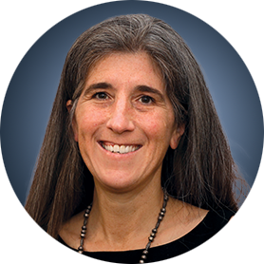
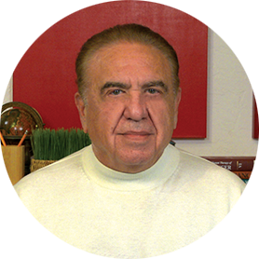

Faculty
Kathleen N Moore, MD, MS
Deputy Director
Virginia Kerley Cade Chair in Developmental Therapeutics
Co-Director, Cancer Therapeutics Program
Stephenson Cancer Center at the University
of Oklahoma HSC
Associate Director, GOG Partners
Board of Directors, GOG Foundation
Board of Directors, ASCO
Oklahoma City, Oklahoma
MODERATOR
Neil Love, MD Research To Practice Miami, Florida
Matthew A Powell, MD
Ira C and Judith Gall Professor
Division of Gynecologic Oncology
Chair, Uterine Corpus Committee
National Cancer Institute-Sponsored NRG Oncology
Washington University School of Medicine
St Louis, Missouri

Slide 3
Commercial Support
This activity is supported by educational grants from GSK and Merck.

Slide 4
Dr Love — Disclosures
Dr Love is president and CEO of Research To Practice. Research To Practice receives funds in the form of educational grants to develop CME activities from the following companies: Aadi Bioscience, AbbVie Inc, ADC Therapeutics, Agendia Inc, Alexion Pharmaceuticals, Amgen Inc, Array BioPharma Inc, a subsidiary of Pfizer Inc, Arvinas, Astellas, AstraZeneca Pharmaceuticals LP, Aveo Pharmaceuticals, Bayer HealthCare Pharmaceuticals, BeOne, Black Diamond Therapeutics Inc, Blueprint Medicines, Boehringer Ingelheim Pharmaceuticals Inc, Bristol Myers Squibb, Clovis Oncology, Coherus BioSciences, Corcept Therapeutics Inc, CTI BioPharma, a Sobi Company, Daiichi Sankyo Inc, Eisai Inc, Elevation Oncology Inc, Exact Sciences Corporation, Exelixis Inc, Genentech, a member of the Roche Group, Genmab US Inc, Geron Corporation, Gilead Sciences Inc, GSK, Helsinn Therapeutics (US) Inc, Hologic Inc, ImmunoGen Inc, Incyte Corporation, Ipsen Biopharmaceuticals Inc, Jazz Pharmaceuticals Inc, Johnson & Johnson, Karyopharm Therapeutics, Kite, A Gilead Company, Kura Oncology, Legend Biotech, Lilly, MEI Pharma Inc, Merck, Mersana Therapeutics Inc, Mirati Therapeutics Inc, Mural Oncology Inc, Natera Inc, Novartis, Novartis Pharmaceuticals Corporation on behalf of Advanced Accelerator Applications, Novocure Inc, Nuvalent, Pfizer Inc, Pharmacyclics LLC, an AbbVie Company, Puma Biotechnology Inc, Regeneron Pharmaceuticals Inc, Rigel Pharmaceuticals Inc, R-Pharm US, Sanofi, Seagen Inc, Servier Pharmaceuticals LLC, SpringWorks Therapeutics Inc, Stemline Therapeutics Inc, Sumitomo Pharma America, Syndax Pharmaceuticals, Taiho Oncology Inc, Takeda Pharmaceuticals USA Inc, TerSera Therapeutics LLC, and Tesaro, A GSK Company.

Slide 5
Research To Practice CME Planning Committee Members, Staff and Reviewers
Planners, scientific staff and independent reviewers for Research To Practice have no relevant conflicts of interest to disclose.

Slide 6
Dr Moore — Disclosures
Advisory Committees | Aadi Bioscience, AbbVie Inc, AstraZeneca Pharmaceuticals LP, BioNTech SE, Blueprint Medicines, Caris Life Sciences, Corcept Therapeutics, Daiichi Sankyo Inc, Duality Biologics, Eisai Inc, Genentech, a member of the Roche Group, GSK, ImmunoGen Inc, Janssen Biotech Inc, Lilly, Merck, Mersana Therapeutics Inc, Novartis, Regeneron Pharmaceuticals Inc, Schrödinger, Takeda Pharmaceuticals USA Inc, Verastem Inc, Zentalis Pharmaceuticals, Zymeworks Inc
Contracted Research | Allarity Therapeutics, Daiichi Sankyo Inc, GSK, ImmunoGen Inc, Schrödinger, Verastem Inc
Data and Safety Monitoring Boards/Committees | Bicycle Therapeutics

Slide 7
Dr Powell — Disclosures
Consulting Agreements | Eisai Inc, GSK, Merck
Contracted Research | GSK

Slide 8
This educational activity contains discussion of non-FDA-approved uses of agents and regimens. Please refer to official prescribing information for each product for approved indications.

Slide 9
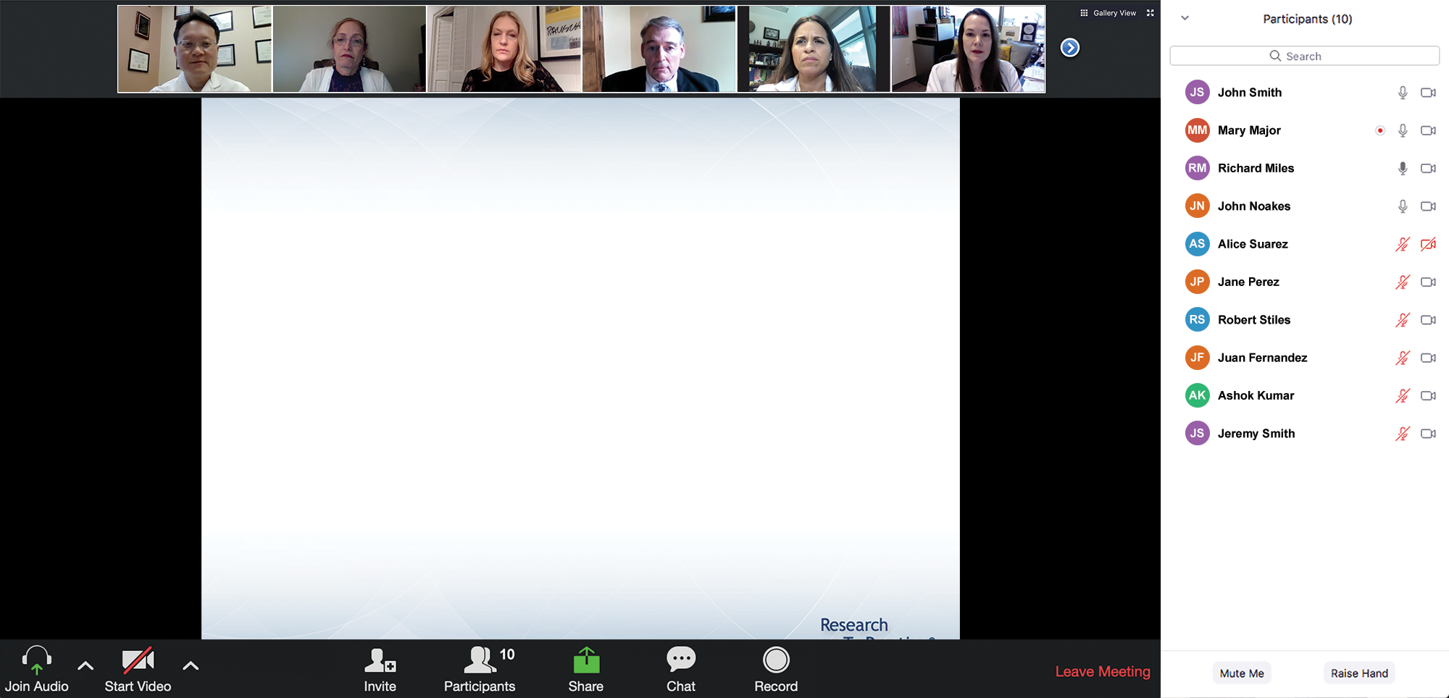

We Encourage Clinicians in Practice to Submit Questions
Feel free to submit questions now before the program begins and throughout the program.

Slide 10
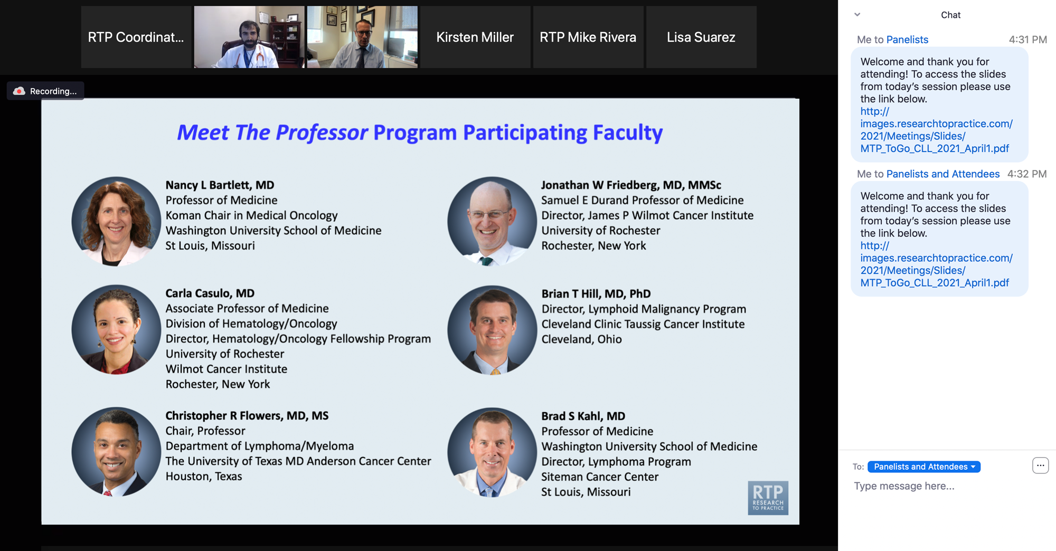
Familiarizing Yourself with the Zoom Interface
Expand chat submission box
Drag the white line above the submission box up to create more space for your message.

Slide 11
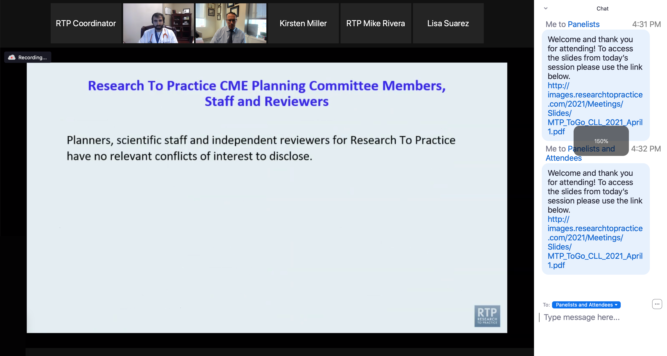
Familiarizing Yourself with the Zoom Interface
Increase chat font size
Press Command (for Mac) or Control (for PC) and the + symbol. You may do this as many times as you need for readability.

Slide 12
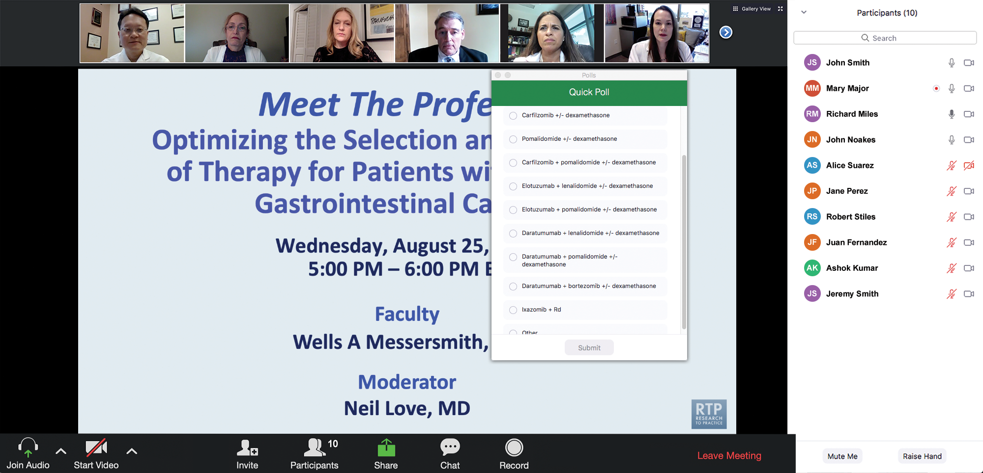
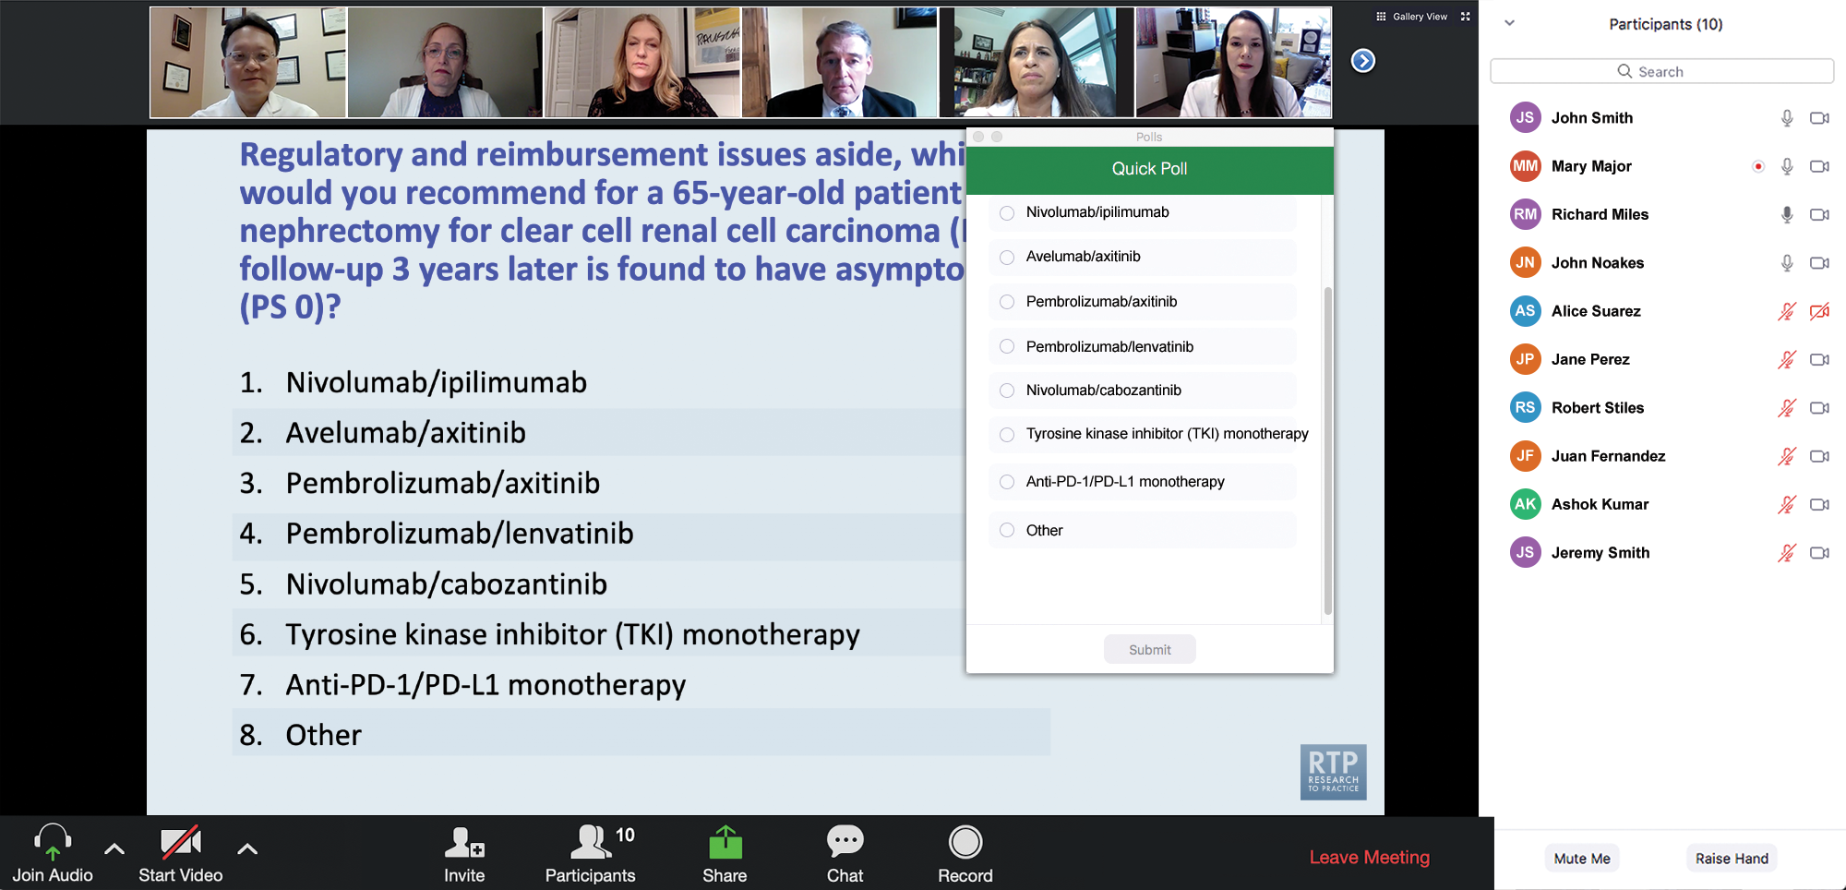
Clinicians in the Audience, Please Complete the Pre- and Postmeeting Surveys
Quick Survey
Quick Poll

Slide 13
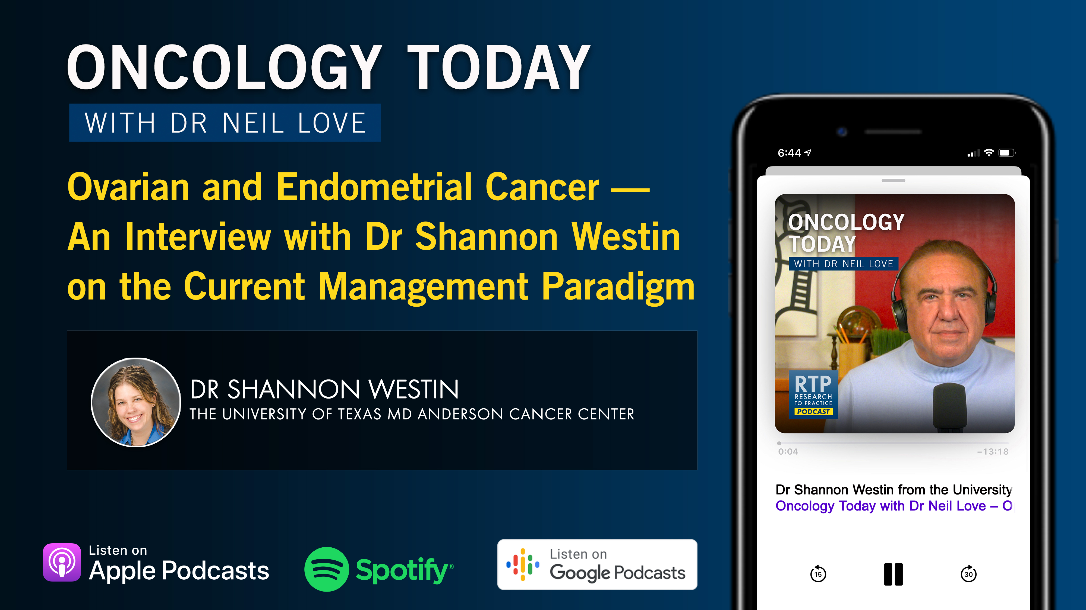

Slide 14
Practical Perspectives: Experts Review Actual Cases of Patients with HER2-Positive Gastrointestinal Cancers
A CME/MOC-Accredited Live Webinar
Tuesday, October 21, 2025​ 5:00 PM – 6:00 PM ET
Faculty
Tanios Bekaii-Saab, MD
Kristen K Ciombor, MD, MSCI
Moderator
Neil Love, MD

Slide 15
Cancer Q&A: Understanding the Role and Reality of CAR (Chimeric Antigen Receptor) T-Cell Therapy for Non-Hodgkin Lymphoma
A Webinar Series for Clinicians and Patients, Developed in Partnership with CancerCare®
Patients
Clinicians
Wednesday, October 22, 2025
6:00 PM – 7:00 PM ET
Wednesday, November 12, 2025
5:00 PM – 6:00 PM ET
Faculty
Jeremy S Abramson, MD, MMSc
Loretta J Nastoupil, MD
Moderator
Neil Love, MD

Slide 16
Exploring Current Patterns of Care in the Community: Optimizing the Use of Oral Selective Estrogen Receptor Degraders for HR-Positive Metastatic Breast Cancer
A CME/MOC-Accredited Live Webinar
Wednesday, October 29, 2025 5:00 PM – 6:00 PM ET
Faculty
Rinath M Jeselsohn, MD
Joyce O’Shaughnessy, MD
Moderator
Neil Love, MD

Slide 17
Integrating New Advances into the Care of Patients with Cancer A Multitumor Symposium in Partnership with the American Oncology Network
Join Us In Person or Virtually
Saturday, November 8, 2025
Lung Cancer
Faculty
Justin F Gainor, MD
Corey J Langer, MD
Chronic Lymphocytic Leukemia
Faculty
Kerry A Rogers, MD
Moderator Stephen “Fred” Divers, MD

Slide 18
Integrating New Advances into the Care of Patients with Cancer A Multitumor Symposium in Partnership with the American Oncology Network
Join Us In Person or Virtually
Saturday, November 8, 2025
Ovarian Cancer
Faculty
To be announced
Gastroesophageal Cancers
Faculty
Manish A Shah, MD
Moderator Stephen “Fred” Divers, MD

Slide 19
What Clinicians Want to Know: First-Line and Maintenance Therapy for Patients with Extensive-Stage Small Cell Lung Cancer
A CME/MOC-Accredited Live Webinar
Tuesday, November 11, 2025 5:00 PM – 6:00 PM ET
Faculty
Luis Paz-Ares, MD, PhD
Misty Dawn Shields, MD, PhD
Moderator
Neil Love, MD

Slide 20
Cancer Conference Update: 2025 ESMO Annual Meeting — Breast Cancer Highlights
CME/MOC-Accredited Live Webinar
Thursday, November 13, 2025​ 5:00 PM – 6:00 PM ET
Faculty
Professor Giuseppe Curigliano, MD, PhD
Priyanka Sharma, MD
Moderator
Neil Love, MD

Slide 21
Preventing and Managing Toxicities Associated with Antibody-Drug Conjugates in the Management of Metastatic Breast Cancer
A CME/MOC-Accredited Live Webinar
Wednesday, November 19, 2025 5:00 PM – 6:00 PM ET
Faculty
Lisa A Carey, MD, ScM, FASCO
Rita Nanda, MD
Moderator
Neil Love, MD

Slide 22
Exciting CME Events You Do Not Want to Miss
A Friday Satellite Symposium Series Preceding the 67th ASH Annual Meeting
Friday, December 5, 2025
Acute Myeloid Leukemia
7:30 AM – 9:30 AM ET
Myelofibrosis and Systemic Mastocytosis
3:15 PM – 5:15 PM ET
Chronic Lymphocytic Leukemia
11:30 AM – 1:30 PM ET
Follicular Lymphoma and
Diffuse Large B-Cell Lymphoma
7:00 PM – 9:00 PM ET

Slide 23
Cases from the Community: Investigators Discuss the Optimal Management of Breast Cancer
A 3-Part CME Satellite Symposium Series
Antibody-Drug Conjugates for
Metastatic Breast Cancer
Tuesday, December 9, 2025
7:00 PM – 8:30 PM CT
HER2-Positive Breast Cancer
Wednesday, December 10, 2025
7:00 PM – 9:00 PM CT
Endocrine-Based Therapy
Thursday, December 11, 2025
7:00 PM – 9:00 PM CT
Moderator
Neil Love, MD

Slide 24
Optimizing Treatment for Patients with Relapsed/Refractory Chronic Lymphocytic Leukemia
A CME/MOC-Accredited Interactive Grand Rounds Series
October 2025 to March 2026
Steering Committee
Catherine C Coombs, MD
Matthew S Davids, MD, MMSc
Bita Fakhri, MD, MPH
Nicole Lamanna, MD
Jeff Sharman, MD
Jennifer Woyach, MD
Host a 1-hour session at your institution: Email Meetings@ResearchToPractice.com or call (800) 233-6153

Slide 25
Thank you for joining us! Please take a moment to complete the survey currently up on Zoom. Your feedback is very important to us. Information on how to obtain CME, ABIM MOC and ABS credit will be provided at the conclusion of the activity in the Zoom chat room. Attendees will also receive an email in 1 to 3 business days with these instructions.

Slide 26
Practical Perspectives: Experts Review Actual Cases of Patients with Endometrial Cancer
A CME/MOC-Accredited Live Webinar
Wednesday, October 15, 2025 5:00 PM – 6:00 PM ET
Faculty
Kathleen N Moore, MD, MS
Matthew A Powell, MD
Moderator
Neil Love, MD

Slide 27
Faculty
Kathleen N Moore, MD, MS
Deputy Director
Virginia Kerley Cade Chair in Developmental Therapeutics
Co-Director, Cancer Therapeutics Program
Stephenson Cancer Center at the University
of Oklahoma HSC
Associate Director, GOG Partners
Board of Directors, GOG Foundation
Board of Directors, ASCO
Oklahoma City, Oklahoma
MODERATOR
Neil Love, MD Research To Practice Miami, Florida
Matthew A Powell, MD
Ira C and Judith Gall Professor
Division of Gynecologic Oncology
Chair, Uterine Corpus Committee
National Cancer Institute-Sponsored NRG Oncology
Washington University School of Medicine
St Louis, Missouri

Slide 28
We Encourage Clinicians in Practice to Submit Questions
Feel free to submit questions now before the program begins and throughout the program.

Slide 29
Clinicians in the Audience, Please Complete the Pre- and Postmeeting Surveys
Quick Survey
Quick Poll

Slide 31
Practical Perspectives: Experts Review Actual Cases of Patients with HER2-Positive Gastrointestinal Cancers
A CME/MOC-Accredited Live Webinar
Tuesday, October 21, 2025​ 5:00 PM – 6:00 PM ET
Faculty
Tanios Bekaii-Saab, MD
Kristen K Ciombor, MD, MSCI
Moderator
Neil Love, MD

Slide 32
Cancer Q&A: Understanding the Role and Reality of CAR (Chimeric Antigen Receptor) T-Cell Therapy for Non-Hodgkin Lymphoma
A Webinar Series for Clinicians and Patients, Developed in Partnership with CancerCare®
Patients
Clinicians
Wednesday, October 22, 2025
6:00 PM – 7:00 PM ET
Wednesday, November 12, 2025
5:00 PM – 6:00 PM ET
Faculty
Jeremy S Abramson, MD, MMSc
Loretta J Nastoupil, MD
Moderator
Neil Love, MD

Slide 33
Exploring Current Patterns of Care in the Community: Optimizing the Use of Oral Selective Estrogen Receptor Degraders for HR-Positive Metastatic Breast Cancer
A CME/MOC-Accredited Live Webinar
Wednesday, October 29, 2025 5:00 PM – 6:00 PM ET
Faculty
Rinath M Jeselsohn, MD
Joyce O’Shaughnessy, MD
Moderator
Neil Love, MD

Slide 34
Integrating New Advances into the Care of Patients with Cancer A Multitumor Symposium in Partnership with the American Oncology Network
Join Us In Person or Virtually
Saturday, November 8, 2025
Lung Cancer
Faculty
Justin F Gainor, MD
Corey J Langer, MD
Chronic Lymphocytic Leukemia
Faculty
Kerry A Rogers, MD
Moderator Stephen “Fred” Divers, MD

Slide 35
Integrating New Advances into the Care of Patients with Cancer A Multitumor Symposium in Partnership with the American Oncology Network
Join Us In Person or Virtually
Saturday, November 8, 2025
Ovarian Cancer
Faculty
To be announced
Gastroesophageal Cancers
Faculty
Manish A Shah, MD
Moderator Stephen “Fred” Divers, MD

Slide 36
What Clinicians Want to Know: First-Line and Maintenance Therapy for Patients with Extensive-Stage Small Cell Lung Cancer
A CME/MOC-Accredited Live Webinar
Tuesday, November 11, 2025 5:00 PM – 6:00 PM ET
Faculty
Luis Paz-Ares, MD, PhD
Misty Dawn Shields, MD, PhD
Moderator
Neil Love, MD

Slide 37
Cancer Conference Update: 2025 ESMO Annual Meeting — Breast Cancer Highlights
CME/MOC-Accredited Live Webinar
Thursday, November 13, 2025​ 5:00 PM – 6:00 PM ET
Faculty
Professor Giuseppe Curigliano, MD, PhD
Priyanka Sharma, MD
Moderator
Neil Love, MD

Slide 38
Preventing and Managing Toxicities Associated with Antibody-Drug Conjugates in the Management of Metastatic Breast Cancer
A CME/MOC-Accredited Live Webinar
Wednesday, November 19, 2025 5:00 PM – 6:00 PM ET
Faculty
Lisa A Carey, MD, ScM, FASCO
Rita Nanda, MD
Moderator
Neil Love, MD

Slide 39
Exciting CME Events You Do Not Want to Miss
A Friday Satellite Symposium Series Preceding the 67th ASH Annual Meeting
Friday, December 5, 2025
Acute Myeloid Leukemia
7:30 AM – 9:30 AM ET
Myelofibrosis and Systemic Mastocytosis
3:15 PM – 5:15 PM ET
Chronic Lymphocytic Leukemia
11:30 AM – 1:30 PM ET
Follicular Lymphoma and
Diffuse Large B-Cell Lymphoma
7:00 PM – 9:00 PM ET

Slide 40
Cases from the Community: Investigators Discuss the Optimal Management of Breast Cancer
A 3-Part CME Satellite Symposium Series
Antibody-Drug Conjugates for
Metastatic Breast Cancer
Tuesday, December 9, 2025
7:00 PM – 8:30 PM CT
HER2-Positive Breast Cancer
Wednesday, December 10, 2025
7:00 PM – 9:00 PM CT
Endocrine-Based Therapy
Thursday, December 11, 2025
7:00 PM – 9:00 PM CT
Moderator
Neil Love, MD

Slide 41
Optimizing Treatment for Patients with Relapsed/Refractory Chronic Lymphocytic Leukemia
A CME/MOC-Accredited Interactive Grand Rounds Series
October 2025 to March 2026
Steering Committee
Catherine C Coombs, MD
Matthew S Davids, MD, MMSc
Bita Fakhri, MD, MPH
Nicole Lamanna, MD
Jeff Sharman, MD
Jennifer Woyach, MD
Host a 1-hour session at your institution: Email Meetings@ResearchToPractice.com or call (800) 233-6153

Slide 42
Practical Perspectives: Experts Review Actual Cases of Patients with Endometrial Cancer
A CME/MOC-Accredited Live Webinar
Wednesday, October 15, 2025 5:00 PM – 6:00 PM ET
Faculty
Kathleen N Moore, MD, MS
Matthew A Powell, MD
Moderator
Neil Love, MD

Slide 43
Dr Moore — Disclosures
Advisory Committees | Aadi Bioscience, AbbVie Inc, AstraZeneca Pharmaceuticals LP, BioNTech SE, Blueprint Medicines, Caris Life Sciences, Corcept Therapeutics, Daiichi Sankyo Inc, Duality Biologics, Eisai Inc, Genentech, a member of the Roche Group, GSK, ImmunoGen Inc, Janssen Biotech Inc, Lilly, Merck, Mersana Therapeutics Inc, Novartis, Regeneron Pharmaceuticals Inc, Schrödinger, Takeda Pharmaceuticals USA Inc, Verastem Inc, Zentalis Pharmaceuticals, Zymeworks Inc
Contracted Research | Allarity Therapeutics, Daiichi Sankyo Inc, GSK, ImmunoGen Inc, Schrödinger, Verastem Inc
Data and Safety Monitoring Boards/Committees | Bicycle Therapeutics

Slide 44
Dr Powell — Disclosures
Consulting Agreements | Eisai Inc, GSK, Merck
Contracted Research | GSK

Slide 45
Dr Love — Disclosures
Dr Love is president and CEO of Research To Practice. Research To Practice receives funds in the form of educational grants to develop CME activities from the following companies: Aadi Bioscience, AbbVie Inc, ADC Therapeutics, Agendia Inc, Alexion Pharmaceuticals, Amgen Inc, Array BioPharma Inc, a subsidiary of Pfizer Inc, Arvinas, Astellas, AstraZeneca Pharmaceuticals LP, Aveo Pharmaceuticals, Bayer HealthCare Pharmaceuticals, BeOne, Black Diamond Therapeutics Inc, Blueprint Medicines, Boehringer Ingelheim Pharmaceuticals Inc, Bristol Myers Squibb, Clovis Oncology, Coherus BioSciences, Corcept Therapeutics Inc, CTI BioPharma, a Sobi Company, Daiichi Sankyo Inc, Eisai Inc, Elevation Oncology Inc, Exact Sciences Corporation, Exelixis Inc, Genentech, a member of the Roche Group, Genmab US Inc, Geron Corporation, Gilead Sciences Inc, GSK, Helsinn Therapeutics (US) Inc, Hologic Inc, ImmunoGen Inc, Incyte Corporation, Ipsen Biopharmaceuticals Inc, Jazz Pharmaceuticals Inc, Johnson & Johnson, Karyopharm Therapeutics, Kite, A Gilead Company, Kura Oncology, Legend Biotech, Lilly, MEI Pharma Inc, Merck, Mersana Therapeutics Inc, Mirati Therapeutics Inc, Mural Oncology Inc, Natera Inc, Novartis, Novartis Pharmaceuticals Corporation on behalf of Advanced Accelerator Applications, Novocure Inc, Nuvalent, Pfizer Inc, Pharmacyclics LLC, an AbbVie Company, Puma Biotechnology Inc, Regeneron Pharmaceuticals Inc, Rigel Pharmaceuticals Inc, R-Pharm US, Sanofi, Seagen Inc, Servier Pharmaceuticals LLC, SpringWorks Therapeutics Inc, Stemline Therapeutics Inc, Sumitomo Pharma America, Syndax Pharmaceuticals, Taiho Oncology Inc, Takeda Pharmaceuticals USA Inc, TerSera Therapeutics LLC, and Tesaro, A GSK Company.

Slide 46
Commercial Support
This activity is supported by educational grants from GSK and Merck.
Research To Practice CME Planning Committee Members, Staff and Reviewers
Planners, scientific staff and independent reviewers for Research To Practice have no relevant conflicts of interest to disclose.

Slide 47
This educational activity contains discussion of non-FDA-approved uses of agents and regimens. Please refer to official prescribing information for each product for approved indications.

Slide 48
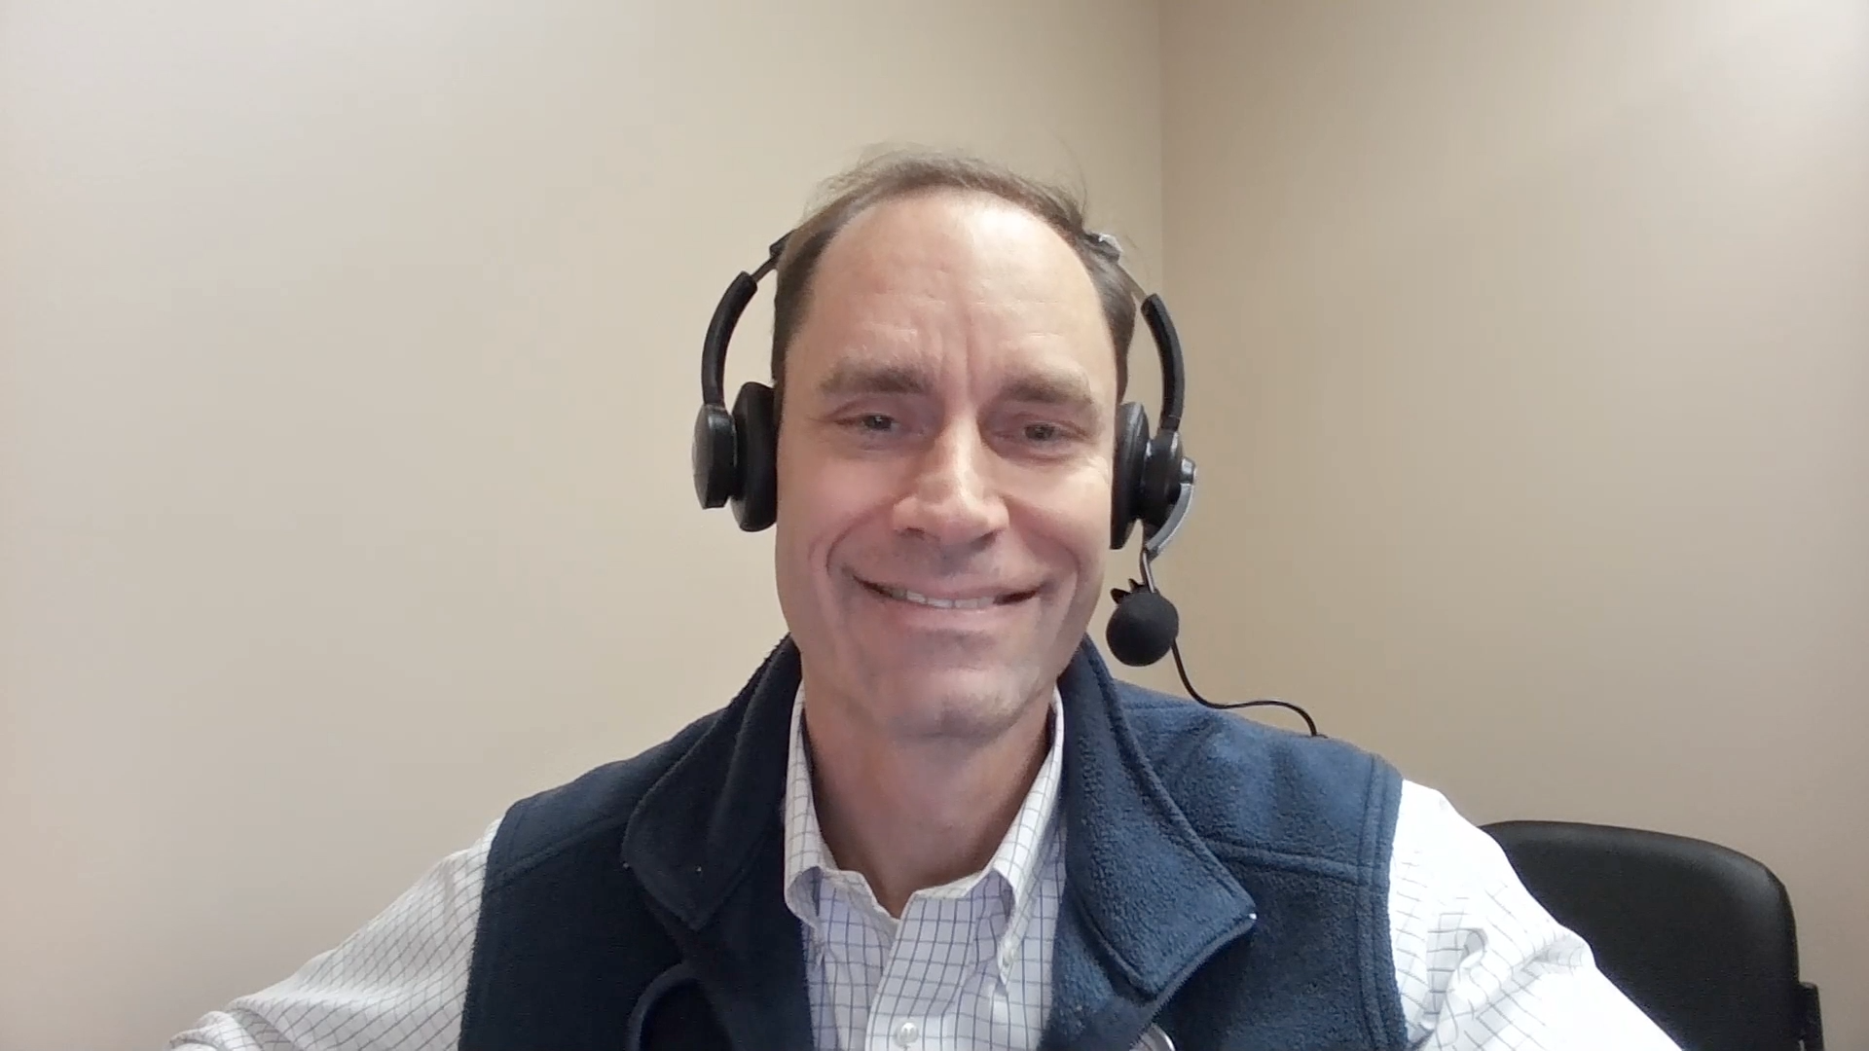
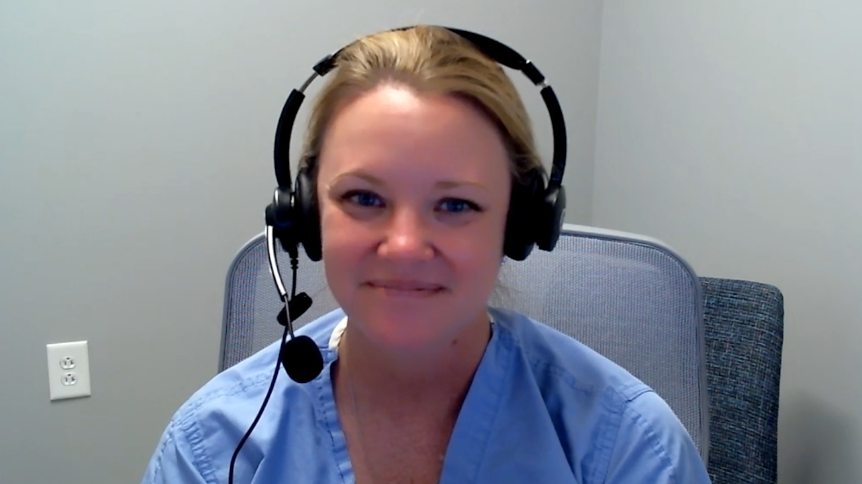
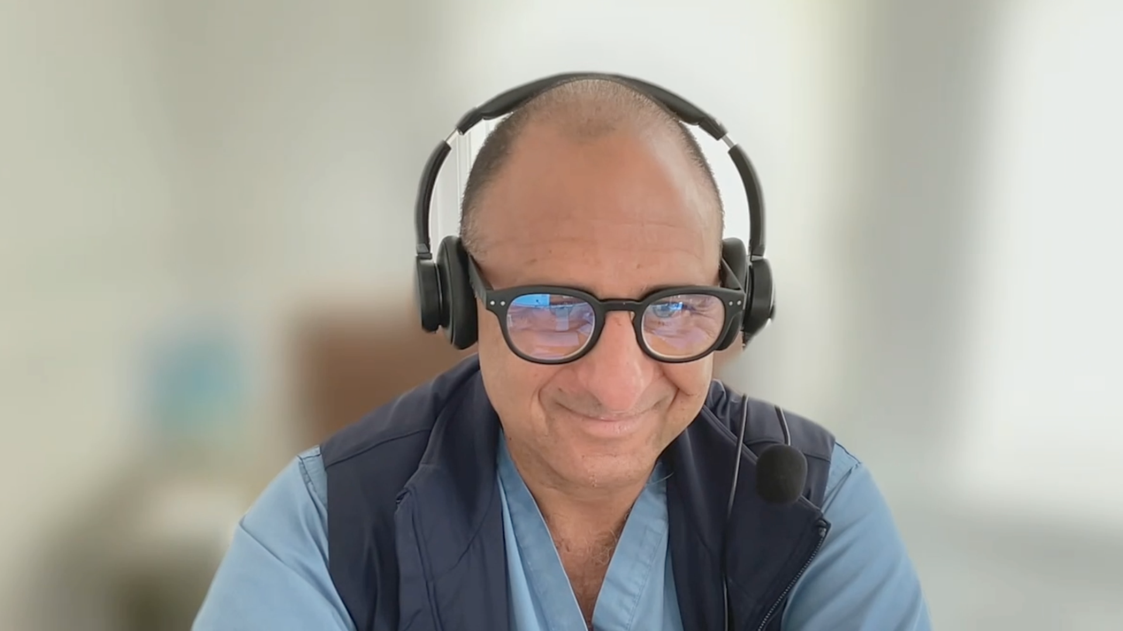

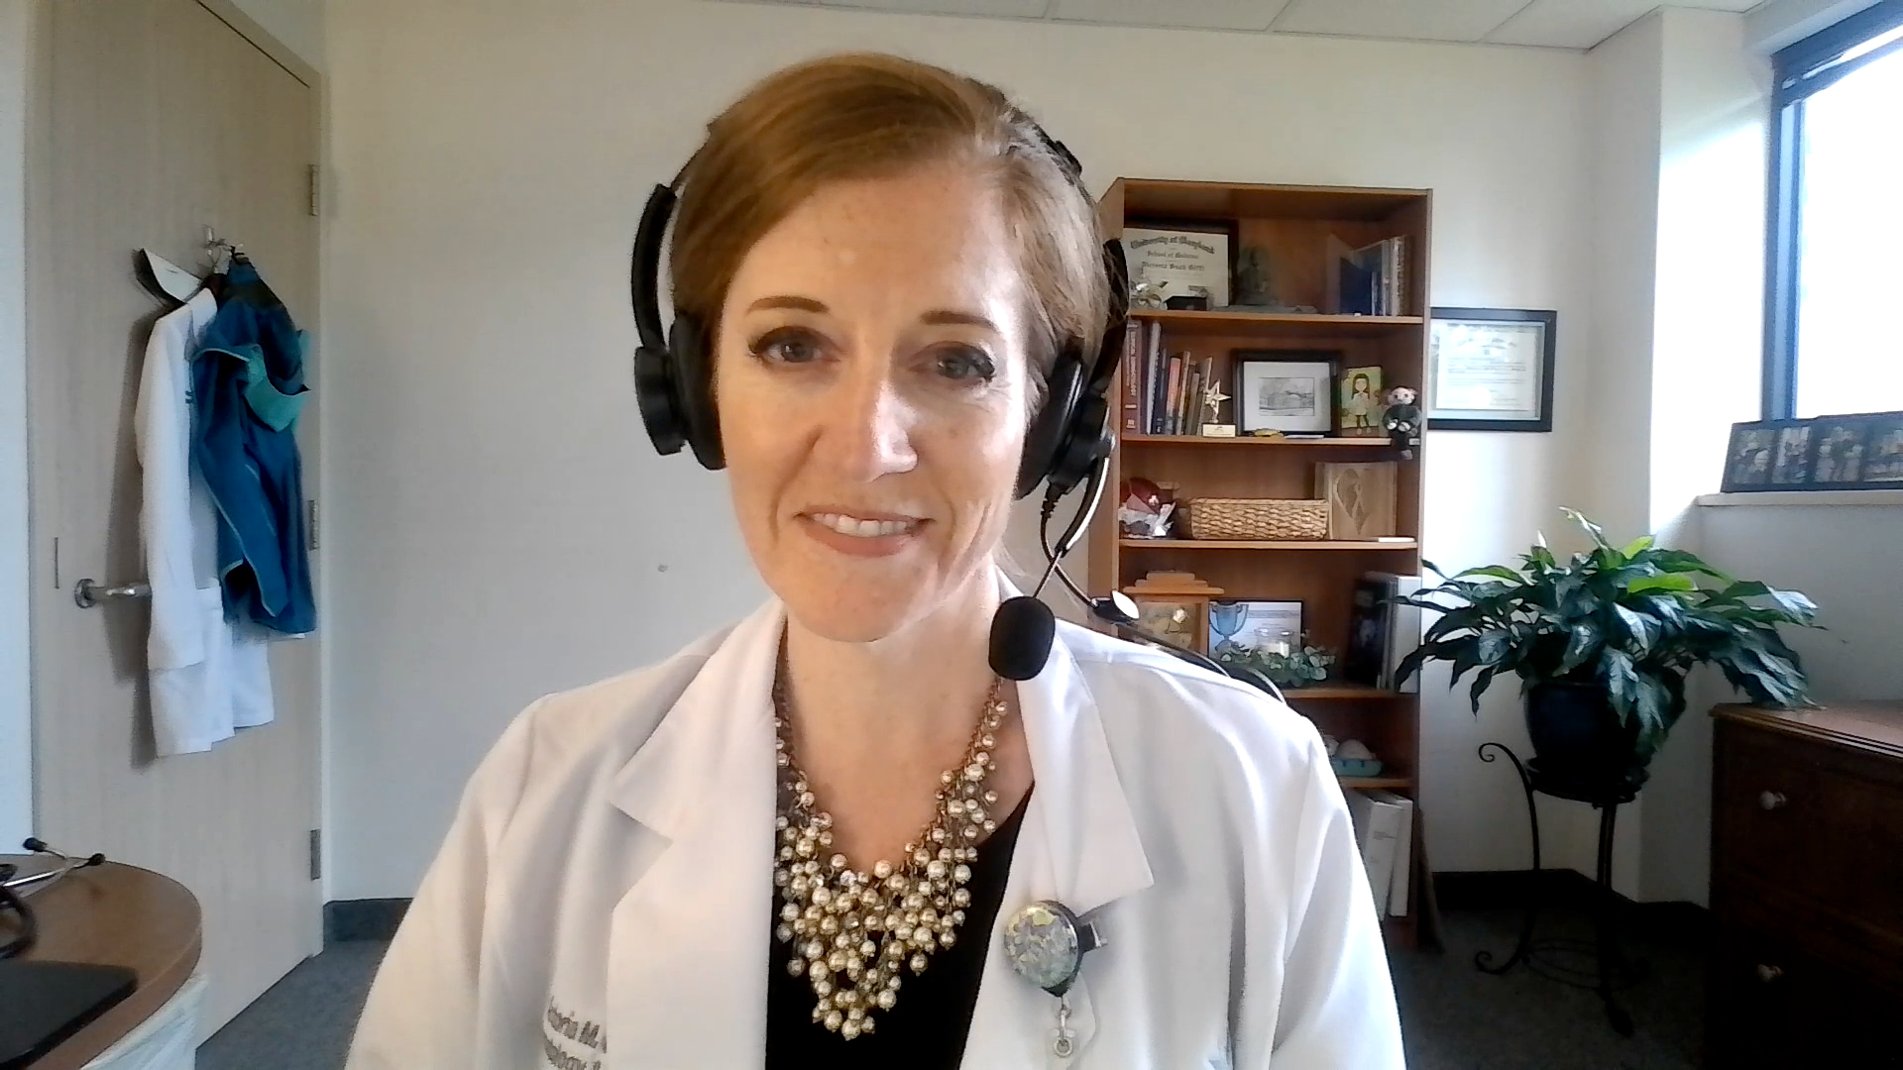


Contributing General Medical Oncologists
Stephen “Fred” Divers, MD
American Oncology Network
Hot Springs, Arkansas
Kellie E Schneider, MD
Novant Health Cancer Institute
Charlotte, North Carolina
Karim ElSahwi, MD
Hackensack Meridian Health
Neptune City, New Jersey
Lyndsay J Willmott, MD
Virginia G Piper Cancer Care Network
Phoenix, Arizona
Victoria Giffi, MD
Meritus Medical Center
Hagerstown, Maryland
Syed F Zafar, MD
Florida Cancer Specialists & Research Institute
Fort Myers, Florida
Shachar Peles, MD
Florida Cancer Specialists & Research Institute
Lake Worth, Florida

Slide 49
Management of Metastatic Endometrial Cancer
Introduction: A pan-tumor perspective on MSI-high disease — Immunotherapy for localized disease
Case 1: Dr Peles – 60-year-old woman
Case 2: Dr Divers – 64-year-old woman
Data Review: Immune Checkpoint Inhibitors
Case 3: Dr Schneider – 32-year-old woman
Case 4: Dr Zafar – 82-year-old woman
Case 5: Dr Willmott – 67-year-old woman
Data Review: HER2-Targeted Treatment
Case 6: Dr Giffi – 73-year-old woman
Case 7: Dr ElSahwi – 68-year-old woman
Data Review: Autoimmune Toxicity with Immunotherapy
Data Review: Novel Antibody-Drug Conjugates

Slide 50
Management of Metastatic Endometrial Cancer
Introduction: A pan-tumor perspective on MSI-high disease — Immunotherapy for localized disease
Case 1: Dr Peles – 60-year-old woman
Case 2: Dr Divers – 64-year-old woman
Data Review: Immune Checkpoint Inhibitors
Case 3: Dr Schneider – 32-year-old woman
Case 4: Dr Zafar – 82-year-old woman
Case 5: Dr Willmott – 67-year-old woman
Data Review: HER2-Targeted Treatment
Case 6: Dr Giffi – 73-year-old woman
Case 7: Dr ElSahwi – 68-year-old woman
Data Review: Autoimmune Toxicity with Immunotherapy
Data Review: Novel Antibody-Drug Conjugates

Slide 51
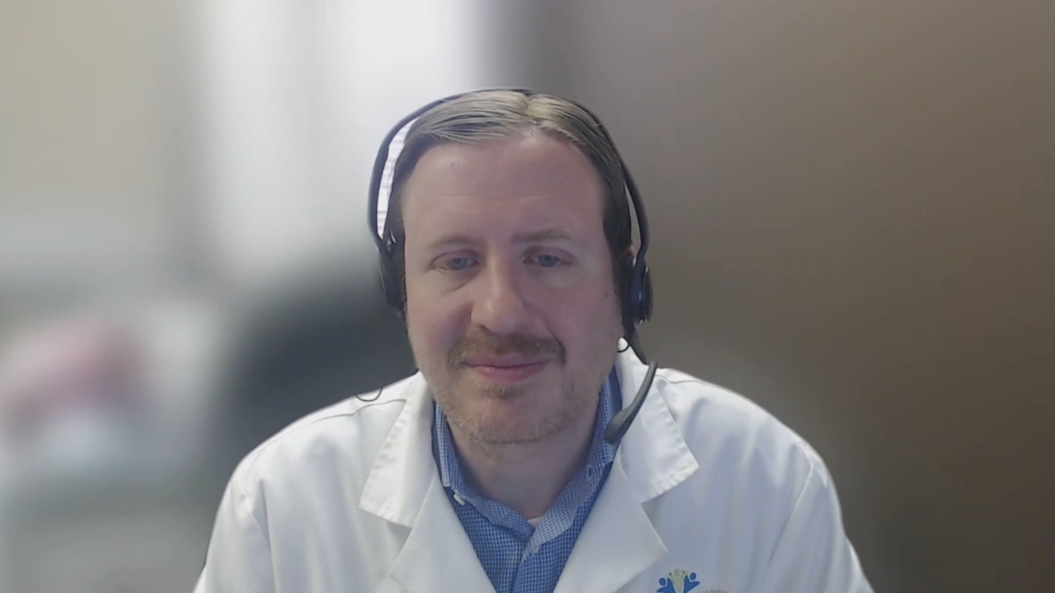
Dr Brian Mulherin (Indianapolis, Indiana)

Slide 52
Case Presentation: Dr Mulherin
74-year-old female who presented with dysfunctional uterine bleeding and abdominal bloating, found to have a large endometrial mass. Imaging ultimately showed an 8.4 cm endometrial mass invading the bladder and causing bilateral hydroureteronephrosis, plus several peritoneal implants and one liver metastasis. Biomarker testing showed tumor dMMR, also p53-mutated, TMB low at 4. HER2 IHC 1+. Received upfront dostarlimab/carboplatin/paclitaxel and had a partial response. However, had disease progression while still on maintenance dostarlimab at 7 months from treatment initiation.
What is the optimal therapy for this patient?
If the tumor was pMMR, with otherwise identical features, what would be the next best treatment option? What’s the activity of pembrolizumab-lenvatinib post-I/O?

Slide 53
Data + Perspectives: Clinical Investigators Explore the Application of Recent Datasets in Current Oncology Care CME/MOC, NCPD and ACPE Accredited
Saturday, October 11, 2025 7:15 AM – 12:30 PM ET

Slide 54
Agenda
Module 1 — Breast Cancer: Drs Burstein, Goetz, McArthur and Nanda
Module 2 — Prostate Cancer: Drs Antonarakis and M Smith
Module 3 — Colorectal Cancer: Drs Lieu and Strickler
Module 4 — Diffuse Large B-Cell Lymphoma and Follicular Lymphoma: Drs Lunning and S Smith

Slide 55


Colorectal Cancer Faculty
Christopher Lieu, MD
Professor of Medicine
Associate Director for Clinical Research
Director, GI Medical Oncology
University of Colorado Cancer Center
Aurora, Colorado
John Strickler, MD
Professor of Medicine
Associate Director, Clinical Research – GI
Co-Leader, Molecular Tumor Board
Duke University
Durham, North Carolina

Slide 56
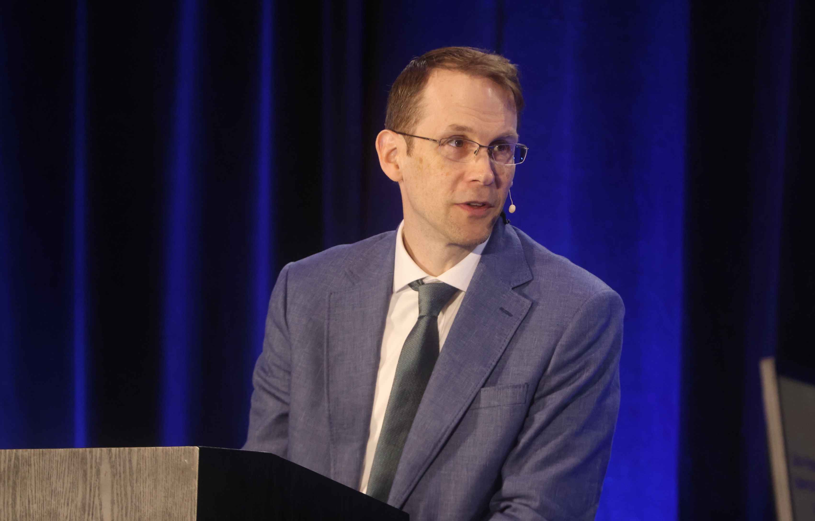
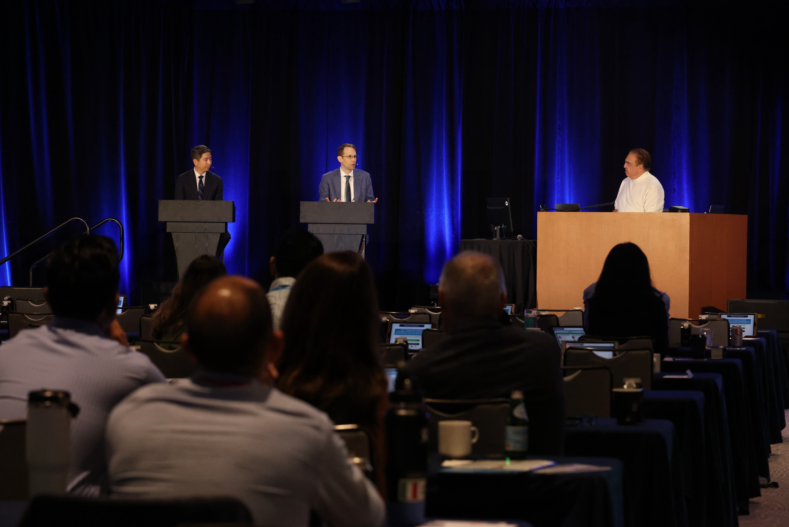
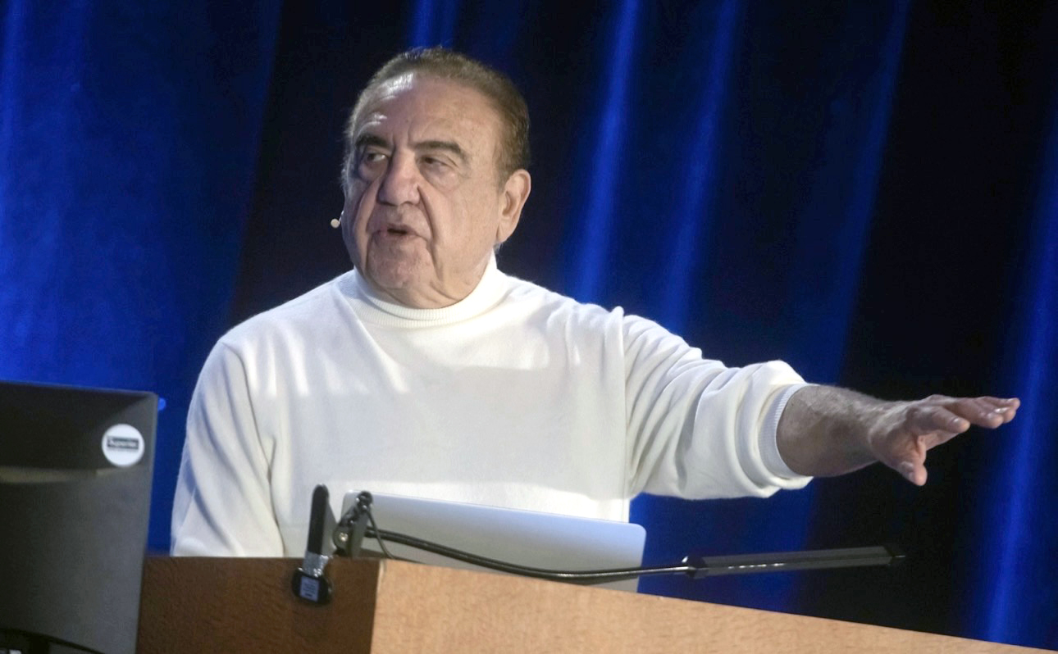
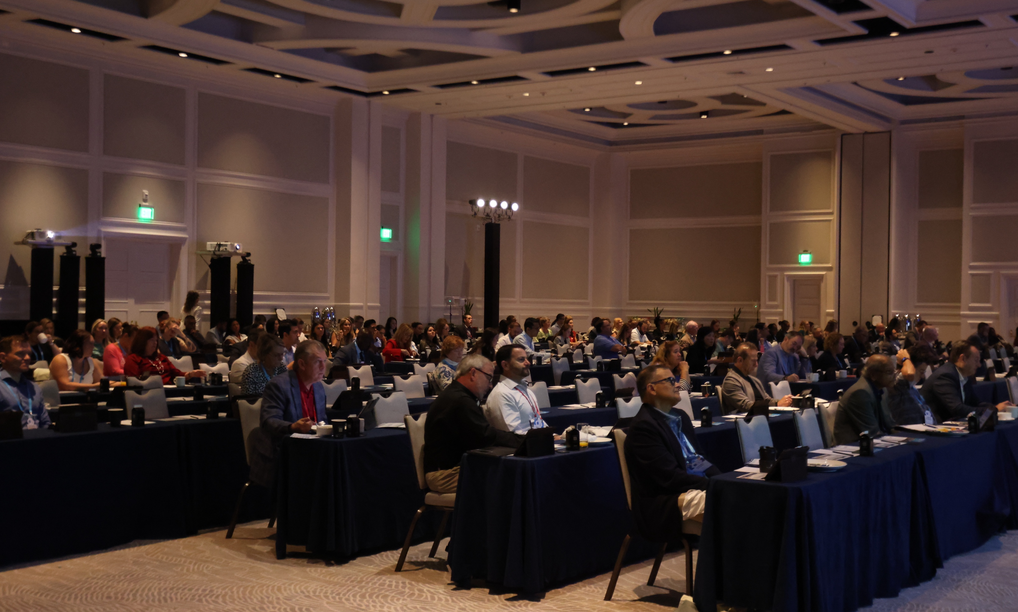
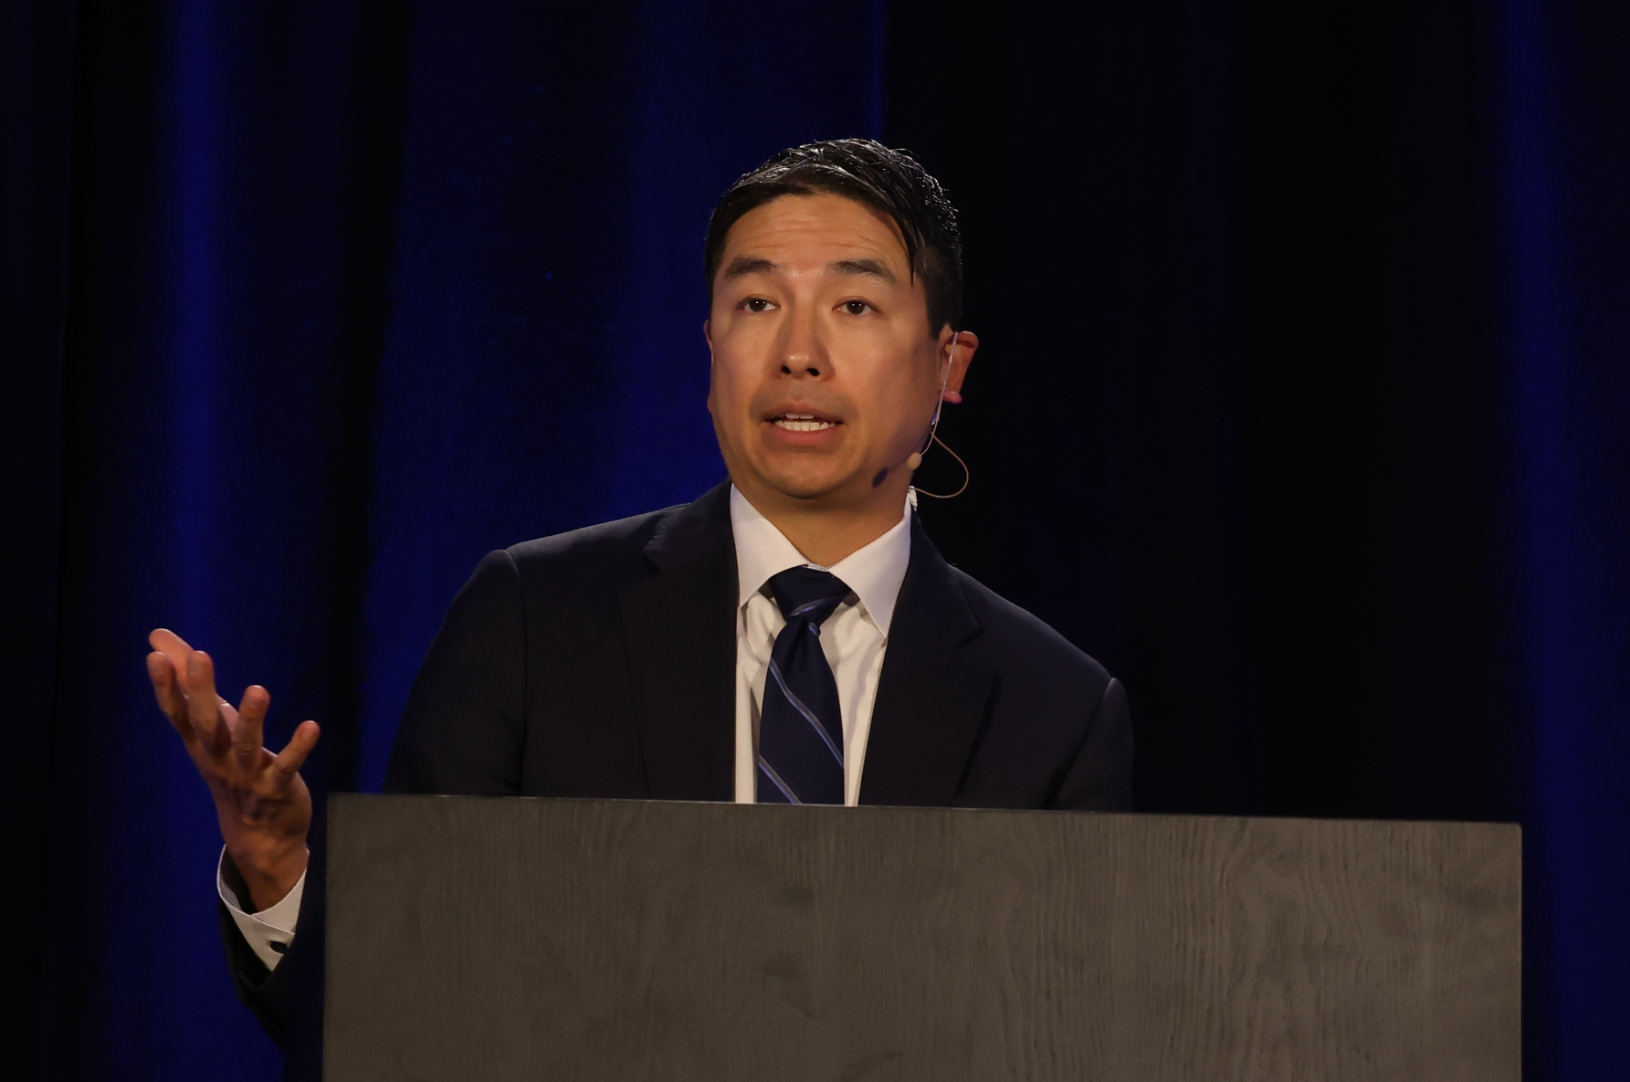
Colorectal Cancer Session at FCS 2025

Slide 57
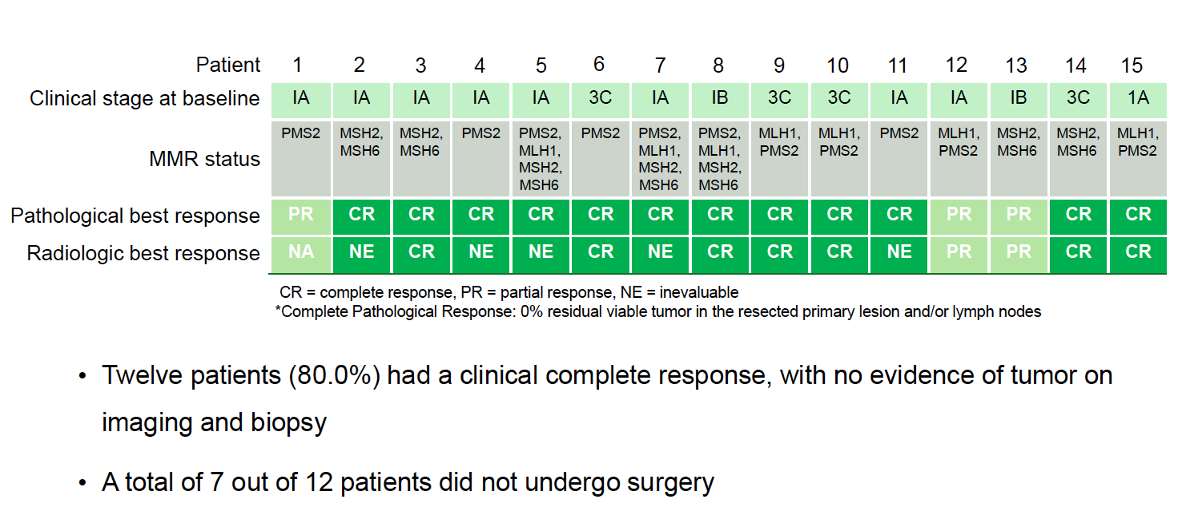
Phase II Study of Nivolumab for Patients with Surgically Completely Resectable Mismatch Repair (MMR)-Deficient Endometrial Cancer
Response in Patients Completing Nivolumab
Grade 3 adverse events were reported in 2 patients, but none led to permanent discontinuation of nivolumab
Lee YJ et al. SGO 2025;Abstract 04.

Slide 58
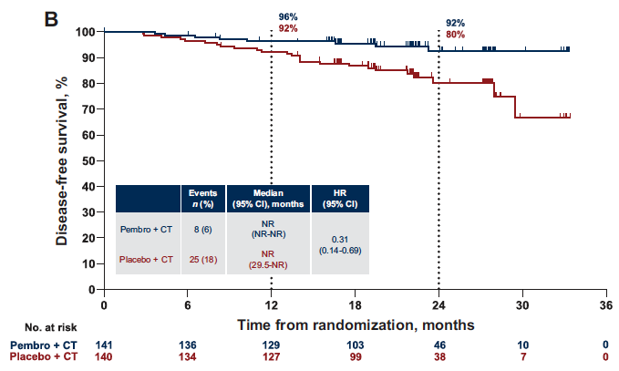
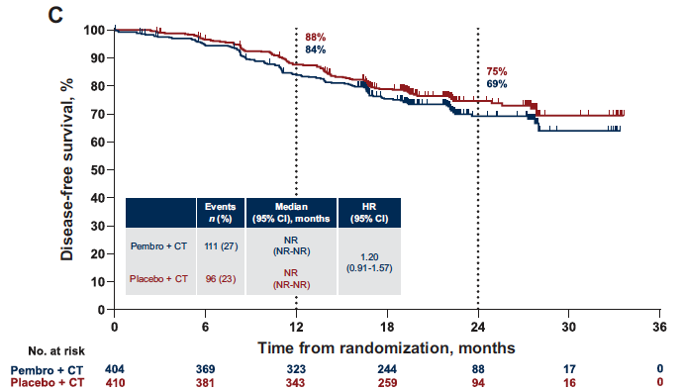
Phase III KEYNOTE-B21 Study of Pembrolizumab with Adjuvant Chemotherapy with or without Radiation Chemotherapy for Newly Diagnosed, High-Risk Endometrial Cancer
dMMR population
pMMR population
In the overall population (n = 1,095), the median DFS was not reached in either treatment group and the HR for DFS was 1.02 (p = 0.570).
Safety was manageable.
dMMR = mismatch repair-deficient; CT = chemotherapy; pMMR = mismatch repair-proficient; DFS = disease-free survival
Van Gorp T et al. Ann Oncol 2024;35(11):968-80.

Slide 59
Select Ongoing Trials of Neoadjuvant Immunotherapy for Localized Endometrial Cancer
Trial identifier | Phase | Study population | Treatment arms | Estimated primary completion date
NADIA (NCT07013851) | II | Stage II–III dMMR/MSI-H | Stage II: Dostarlimab → VBT/EBRT + adjuvant dostarlimab Stage III: Dostarlimab → concurrent EBRT + chemotherapy Dostarlimab → sequential EBRT + chemotherapy Dostarlimab → chemotherapy alone Adjuvant dostarlimab | March 2029
RODEO (NCT07115927) | II | Stage II–IV | Dostarlimab (2 doses) → surgery | April 2030
PAM-UMCG-002 (NCT06180733) | II | Grade 3/CC, dMMR | Pembrolizumab → surgery | December 2027
MSI-H = microsatellite instability-high; VBT = vaginal brachytherapy; EBRT = external beam radiation therapy
www.clinicaltrials.gov. Accessed October 2025.

Slide 60
Select Ongoing Trials of Adjuvant Immunotherapy for Localized Endometrial Cancer (EC)
Trial identifier | Phase | Study population | Treatment arms | Estimated primary completion date
MMRd-GREEN (NCT05255653-2) | III | High-risk, dMMR EC after curative intent surgery | Durvalumab + RT RT | January 2030
NRG-GY020 (NCT04214067) | III | Stage II–IV | Pembrolizumab + EBRT/VBT EBRT/VBT | December 2025
www.clinicaltrials.gov. Accessed October 2025.

Slide 61
Management of Metastatic Endometrial Cancer
Introduction: A pan-tumor perspective on MSI-high disease — Immunotherapy for localized disease
Case 1: Dr Peles – 60-year-old woman
Case 2: Dr Divers – 64-year-old woman
Data Review: Immune Checkpoint Inhibitors
Case 3: Dr Schneider – 32-year-old woman
Case 4: Dr Zafar – 82-year-old woman
Case 5: Dr Willmott – 67-year-old woman
Data Review: HER2-Targeted Treatment
Case 6: Dr Giffi – 73-year-old woman
Case 7: Dr ElSahwi – 68-year-old woman
Data Review: Autoimmune Toxicity with Immunotherapy
Data Review: Novel Antibody-Drug Conjugates

Slide 62
Case Presentation: 60-year-old woman with MSI-H metastatic endometrial carcinoma has CR with dostarlimab and paclitaxel/carboplatin
Dr Shachar Peles (Lake Worth, Florida)

Slide 63
Management of Metastatic Endometrial Cancer
Introduction: A pan-tumor perspective on MSI-high disease — Immunotherapy for localized disease
Case 1: Dr Peles – 60-year-old woman
Case 2: Dr Divers – 64-year-old woman
Data Review: Immune Checkpoint Inhibitors
Case 3: Dr Schneider – 32-year-old woman
Case 4: Dr Zafar – 82-year-old woman
Case 5: Dr Willmott – 67-year-old woman
Data Review: HER2-Targeted Treatment
Case 6: Dr Giffi – 73-year-old woman
Case 7: Dr ElSahwi – 68-year-old woman
Data Review: Autoimmune Toxicity with Immunotherapy
Data Review: Novel Antibody-Drug Conjugates

Slide 64
Case Presentation: 64-year-old woman with MSI-H, somatic BRCA1-mutant endometrial cancer has CR with carboplatin/paclitaxel/pembrolizumab
Dr Fred Divers (Hot Springs, Arkansas)

Slide 65
Management of Metastatic Endometrial Cancer
Introduction: A pan-tumor perspective on MSI-high disease — Immunotherapy for localized disease
Case 1: Dr Peles – 60-year-old woman
Case 2: Dr Divers – 64-year-old woman
Data Review: Immune Checkpoint Inhibitors
Case 3: Dr Schneider – 32-year-old woman
Case 4: Dr Zafar – 82-year-old woman
Case 5: Dr Willmott – 67-year-old woman
Data Review: HER2-Targeted Treatment
Case 6: Dr Giffi – 73-year-old woman
Case 7: Dr ElSahwi – 68-year-old woman
Data Review: Autoimmune Toxicity with Immunotherapy
Data Review: Novel Antibody-Drug Conjugates

Slide 66
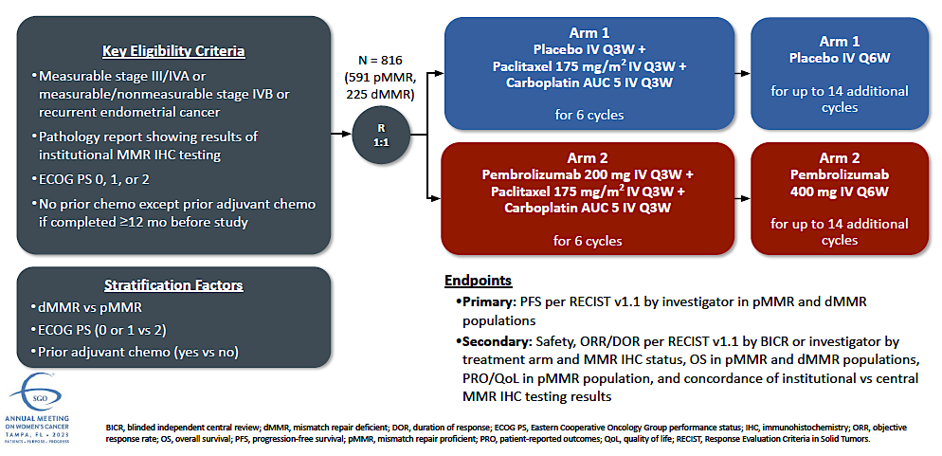
NRG-GY018 Phase III Study Design
Eskander RN et al. SGO 2022;Abstract 264.

Slide 67
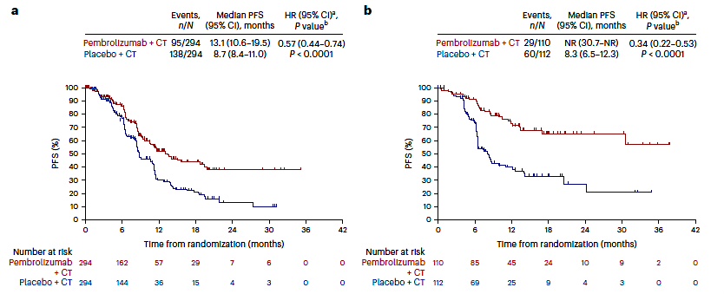
NRG-GY018: Investigator-Assessed Progression-Free Survival (PFS) by Mismatch Repair (MMR) Status
pMMR
dMMR
Eskander RN et al. Nat Med 2025;31(5):1539-46.

Slide 68
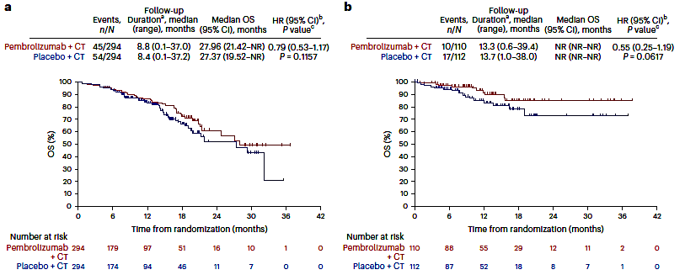
NRG-GY018: Interim Analysis of Overall Survival (OS) by MMR Status
pMMR
dMMR
Eskander RN et al. Nat Med 2025;31(5):1539-46.

Slide 69
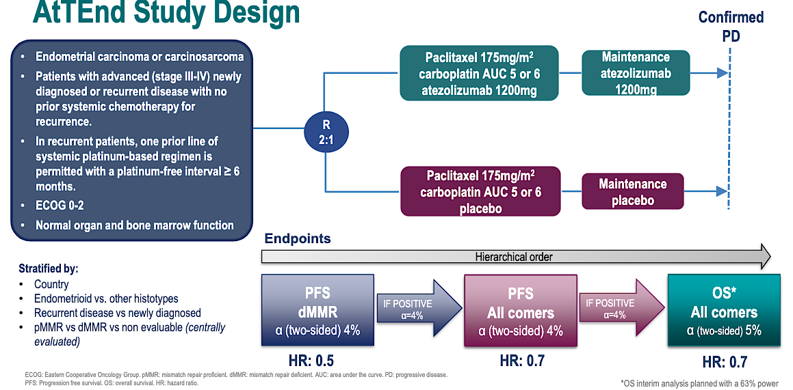
AtTEnd Phase III Study Design
Colombo N et al. ESMO 2023;Abstract LBA40.

Slide 70
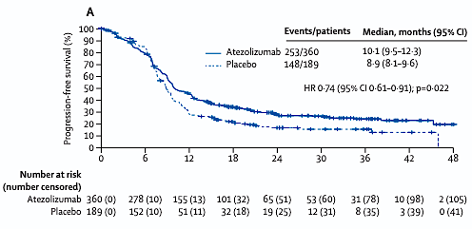
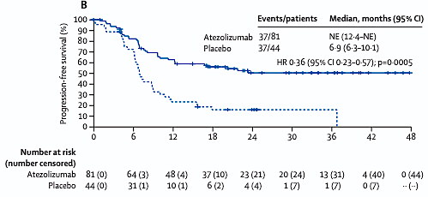
AtTEnd: PFS in the Overall and dMMR Populations
Overall population
dMMR population
Colombo N et al. Lancet Oncol 2024;25:1135-46.

Slide 71
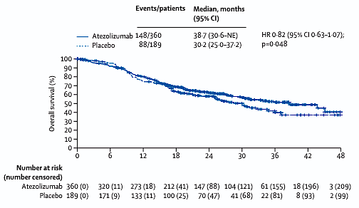
AtTEnd: Interim Analysis of OS in the Overall Population
Colombo N et al. Lancet Oncol 2024;25:1135-46.

Slide 72
Final Overall Survival (OS) Results from the Randomized Double-Blind Phase III AtTEnd/ENGOT-EN7 Trial Evaluating Atezolizumab in Combination with Paclitaxel and Carboplatin in Women with Advanced/Recurrent Endometrial Cancer
Ginesta MPB et al.
ESMO 2025;Abstract LBA39.
PROFERRED PAPER | SUNDAY, OCTOBER 19 | 14:55 CEST

Slide 73
WES-Derived Aneuploidy Score (W-AS) Identifies MMRd Patients with Reduced Benefit from Immunotherapy in Endometrial Cancer: Multi-omic Analysis of the Phase III AtTEnd/ENGOT-EN7 Trial
Mazarella L et al.
ESMO 2025;Abstract LBA40.
PROFERRED PAPER | SUNDAY, OCTOBER 19 | 10:15 CEST

Slide 74
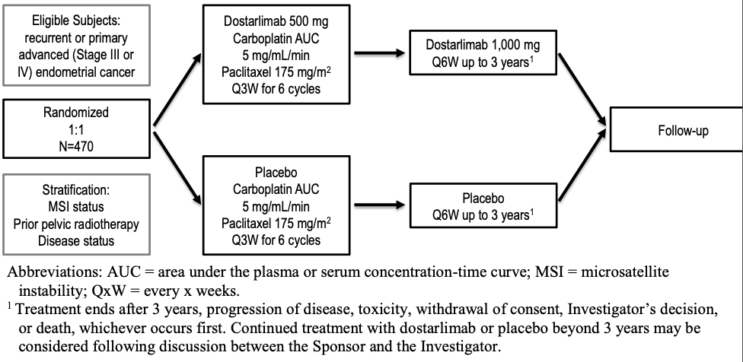
Phase III RUBY Part 1 Study Design
Mirza MR et al. N Engl J Med 2023;388:2145-58.

Slide 75
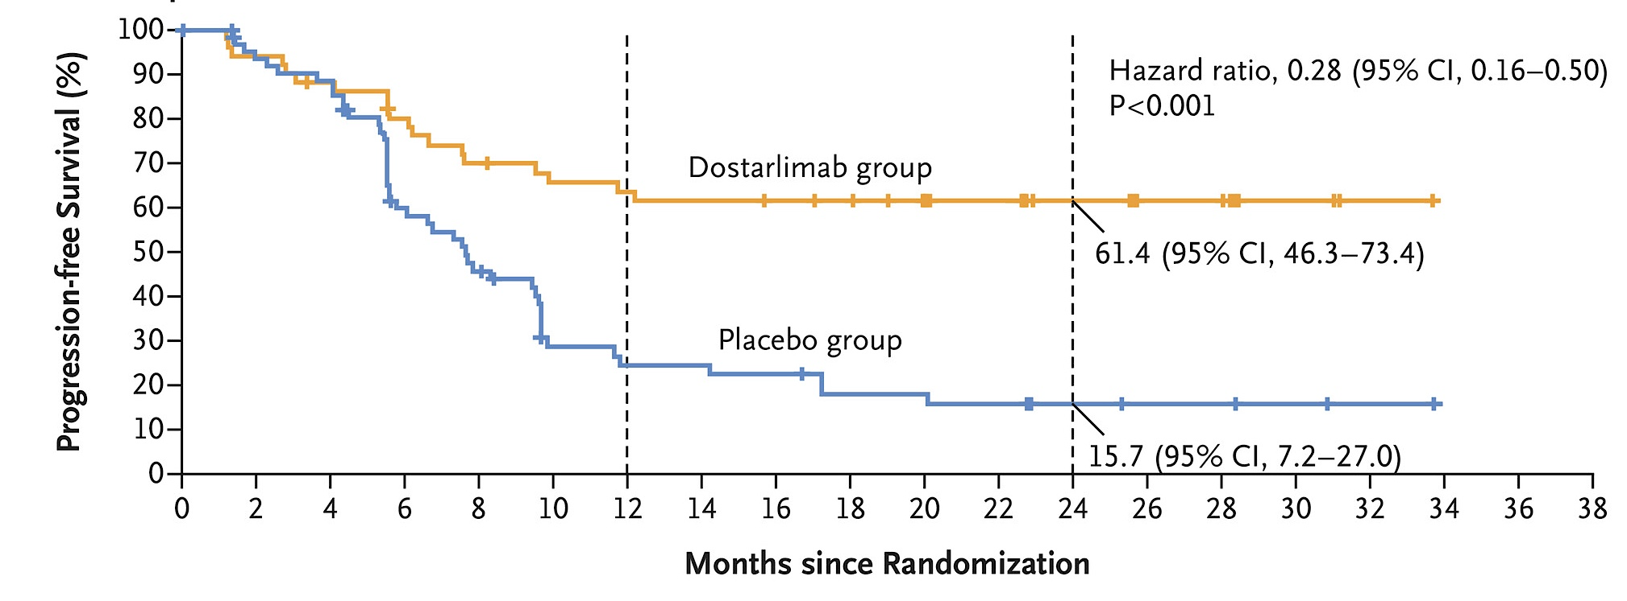
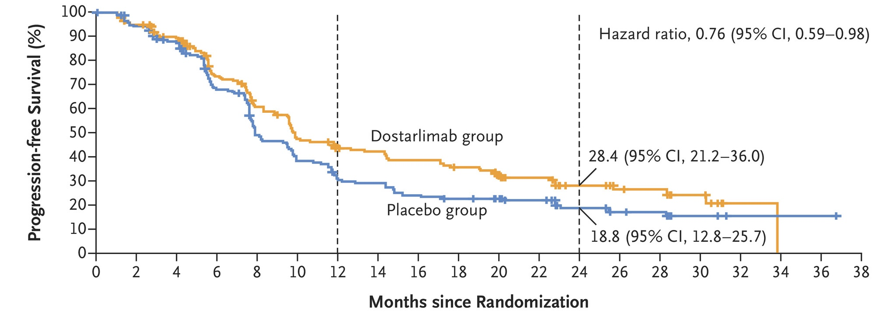
Phase III RUBY Part 1: PFS by Mismatch Repair (MMR) Status
dMMR/MSI-H population
pMMR/MSS population
dMMR = MMR deficient; MSI-H = microsatellite instability high; pMMR = MMR proficient; MSS = microsatellite stable
Mirza MR et al. N Engl J Med 2023;388:2145-58.

Slide 76
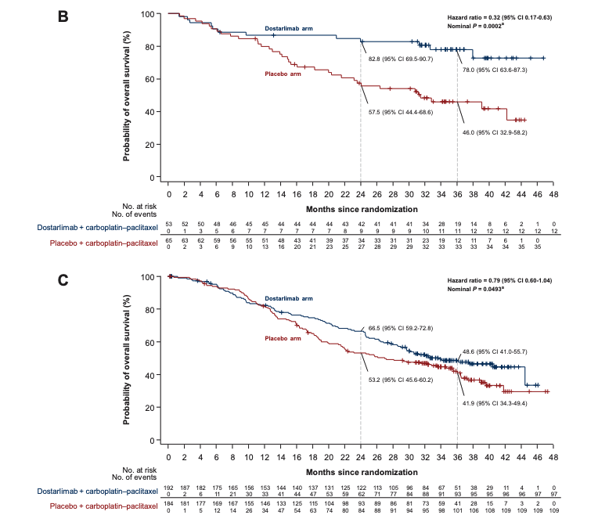
Phase III RUBY Part 1: Overall Survival by MMR Status
dMMR/MSI-H population
pMMR/MSS population
Powell MA et al. Ann Oncol 2024;35(8):728-38.

Slide 77
Post Hoc Survival Outcomes Based on Initial and Subsequent Treatment in Patients (pts) with Mismatch Repair Proficient/Microsatellite Stable (MMRp/MSS) Primary Advanced or Recurrent Endometrial Cancer (pA/R EC) in the ENGOT-EN6-NSGO/GOG-3031/RUBY Trial
Monk BJ et al.
ESMO 2025;Abstract 1113P.
POSTER SESSION 1 | SATURDAY, OCTOBER 18

Slide 78
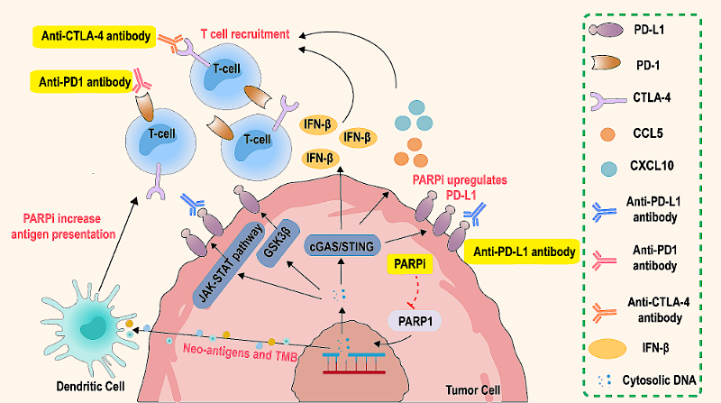
Interaction Between PARP Inhibitors and Immune Checkpoint Inhibitors
Xiao F et al. J Transl Med 2024;22(1):778.

Slide 79
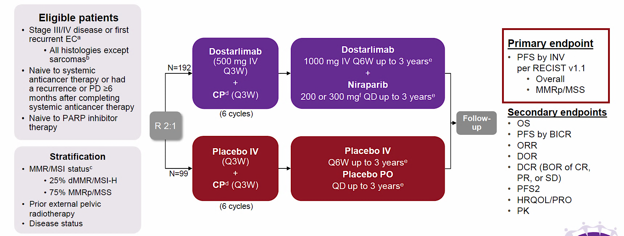
Phase III RUBY Part 2 Study Design
Mirza MR et al. SGO 2024.

Slide 80
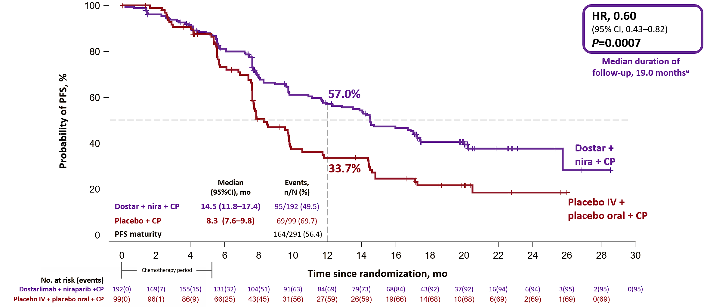
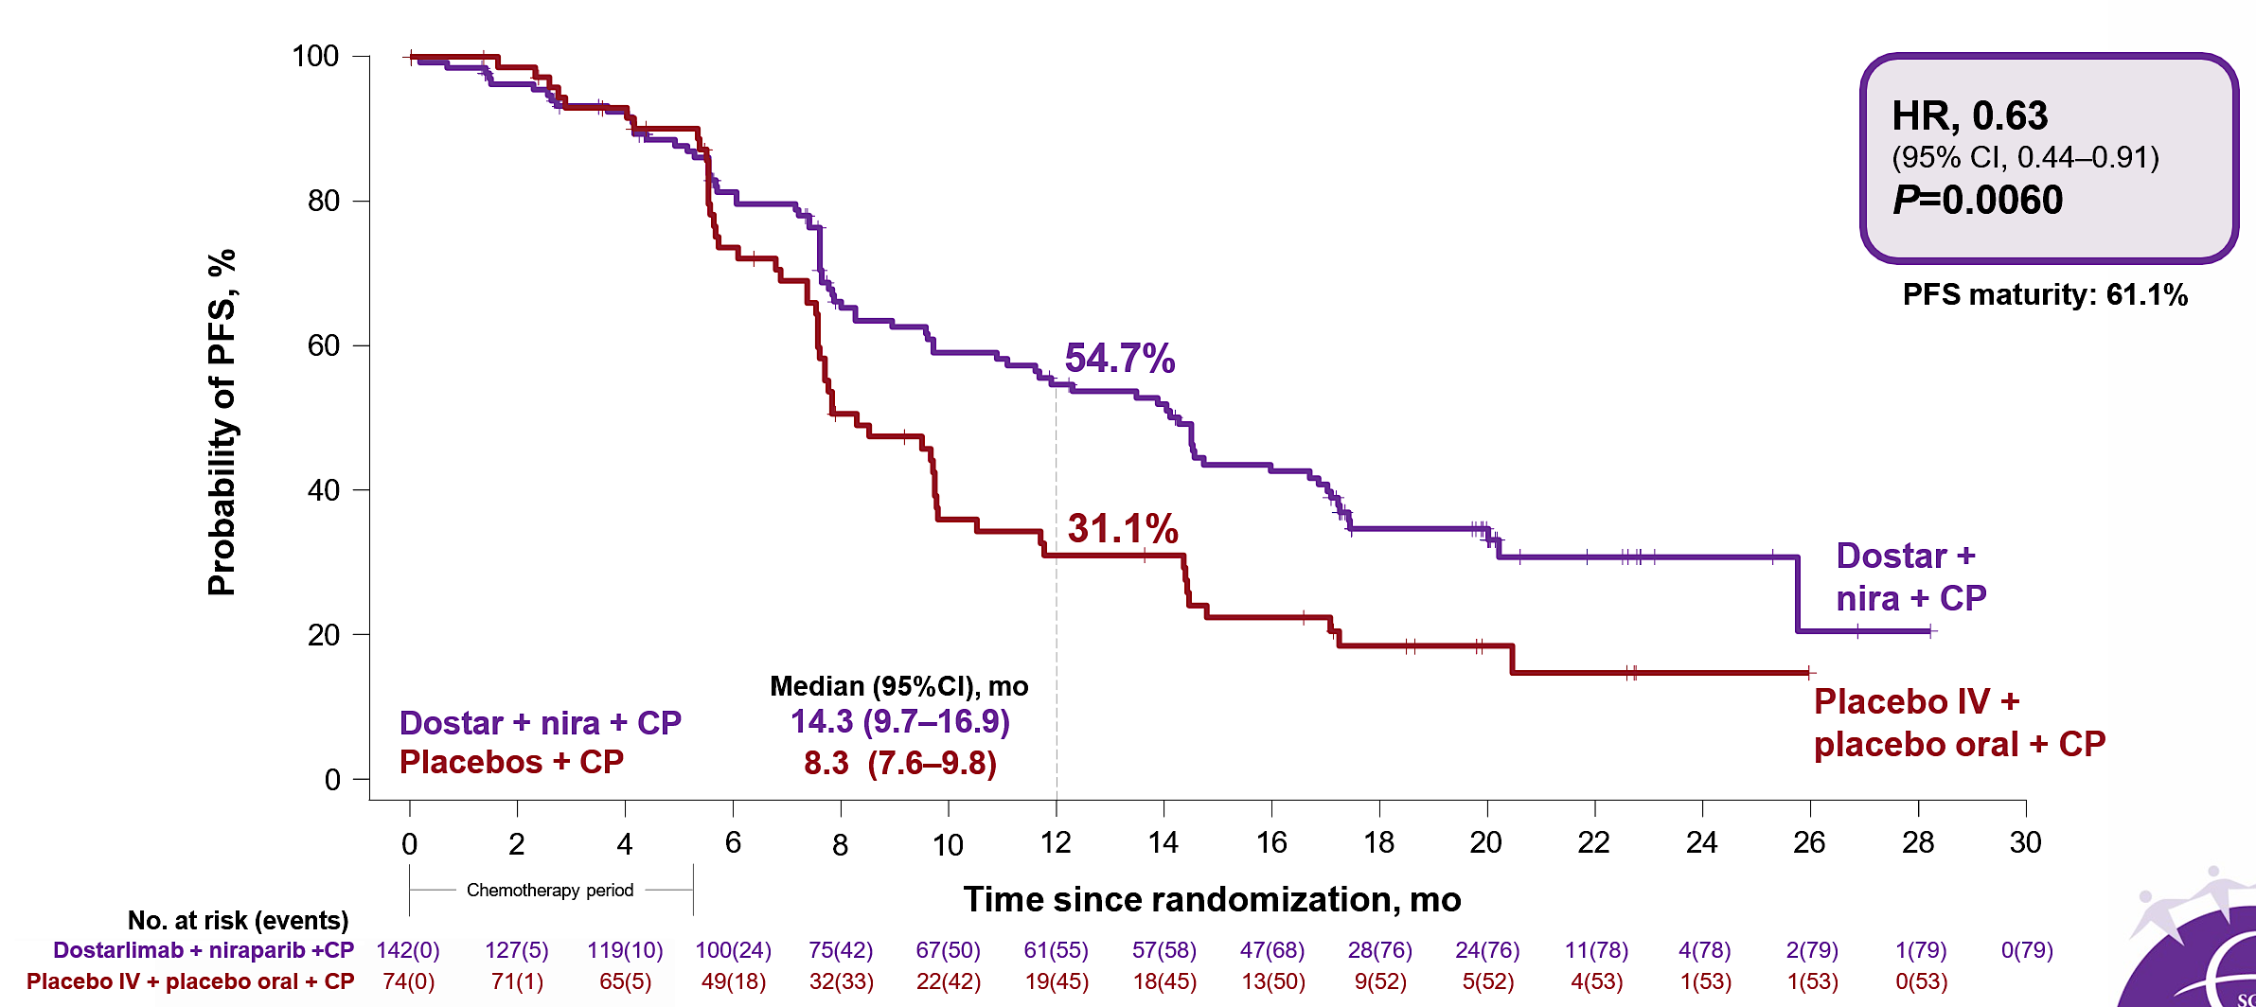
Phase III RUBY Part 2 Coprimary Endpoints: PFS in the Overall and pMMR Populations
Overall population
pMMR/MSS population
Mirza MR et al. SGO 2024.

Slide 81
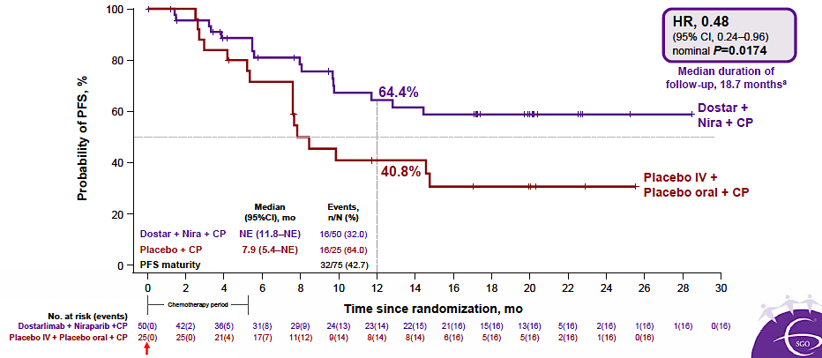
Phase III RUBY Part 2 Exploratory Analysis: PFS in the dMMR/MSI-H Population
Mirza MR et al. SGO 2024.

Slide 82
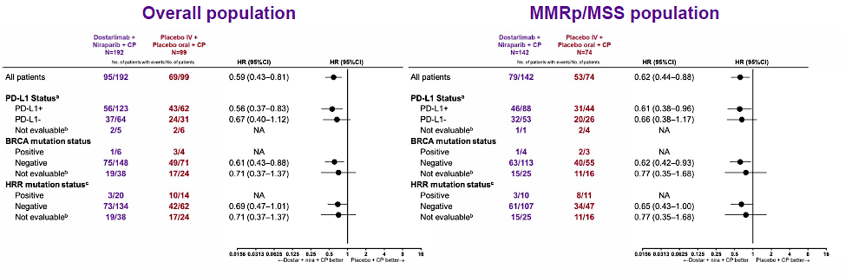
Phase III RUBY Part 2 Exploratory Analysis: PFS by PD-L1, BRCA and Homologous Recombination Repair (HRR) Status
Mirza MR et al. SGO 2024.

Slide 83
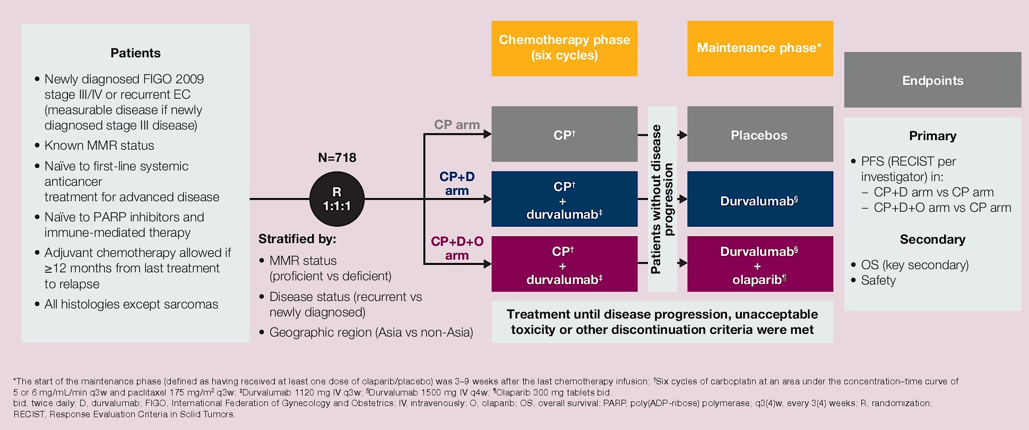
Phase III DUO-E Study Design Durvalumab (D) with Carboplatin (C) and Paclitaxel (P) Followed by Maintenance D with or without Olaparib (O) for Advanced Endometrial Cancer (EC)
Pepin JT et al. ASCO 2024;Abstract 5599.

Slide 84
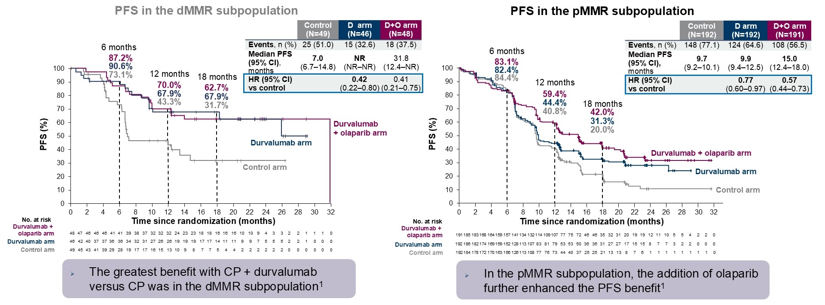
DUO-E: PFS by MMR Status
Westin SN et al. ASCO 2025;Abstract 5512.

Slide 85
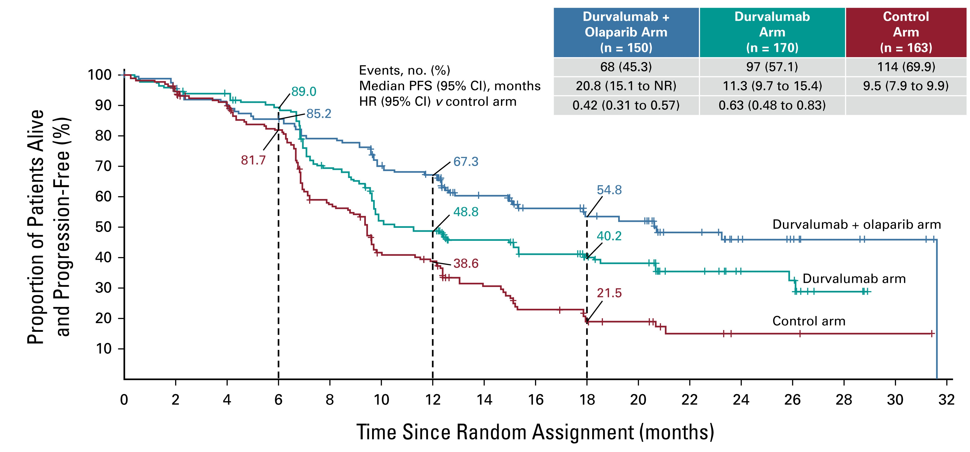
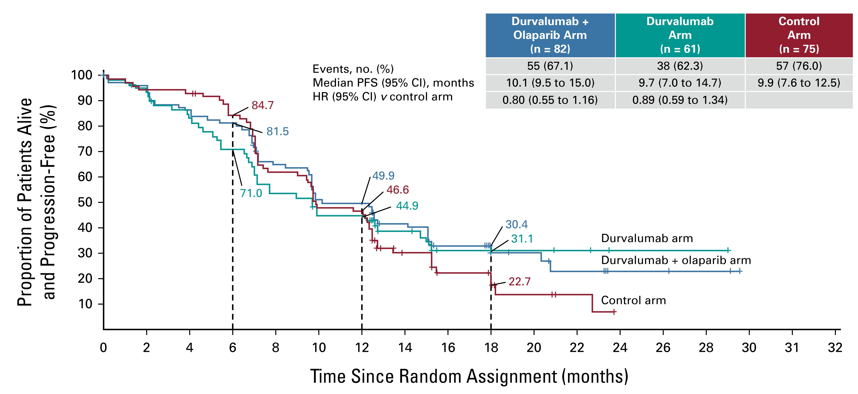
DUO-E: PFS by PD-L1 Status
PD-L1-Positive
PD-L1-Negative
Westin SN et al. J Clin Oncol 2024 January 20;42(3):283-99.

Slide 86
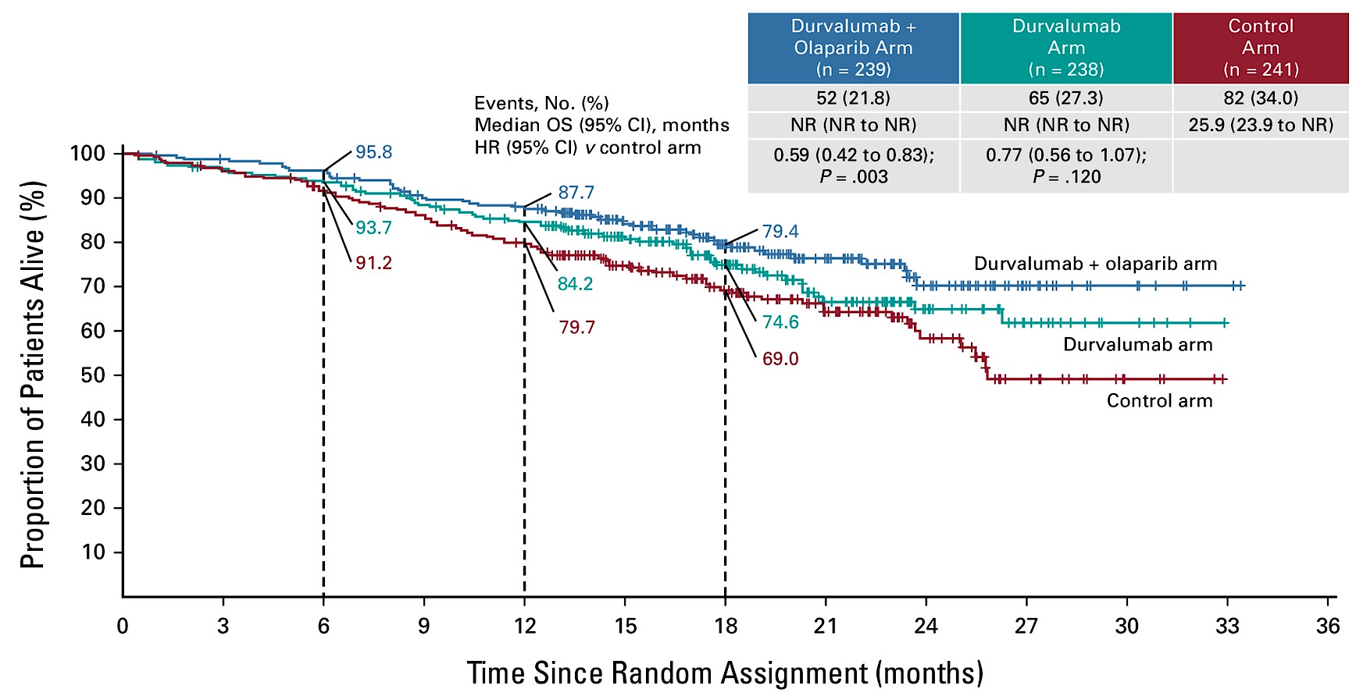
DUO-E: Interim Overall Survival
Westin SN et al. J Clin Oncol 2024 January 20;42(3):283-99.

Slide 87
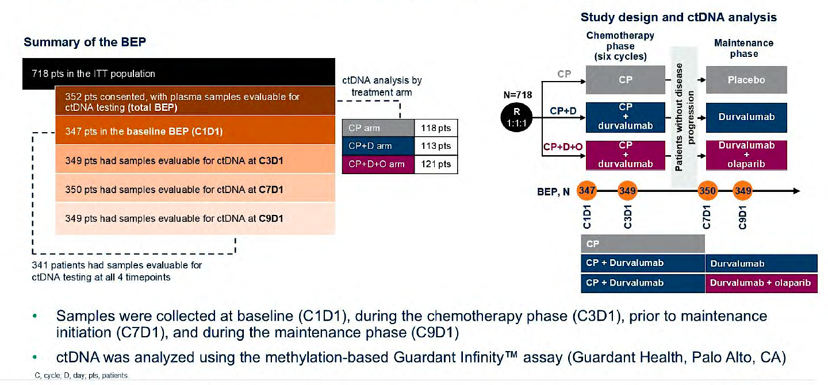
Circulating Tumor DNA (ctDNA) Analysis in DUO-E
BEP = biomarker-evaluable population; ITT = intent-to-treat
Westin S et al. ASCO 2025;Abstract 5512.

Slide 88
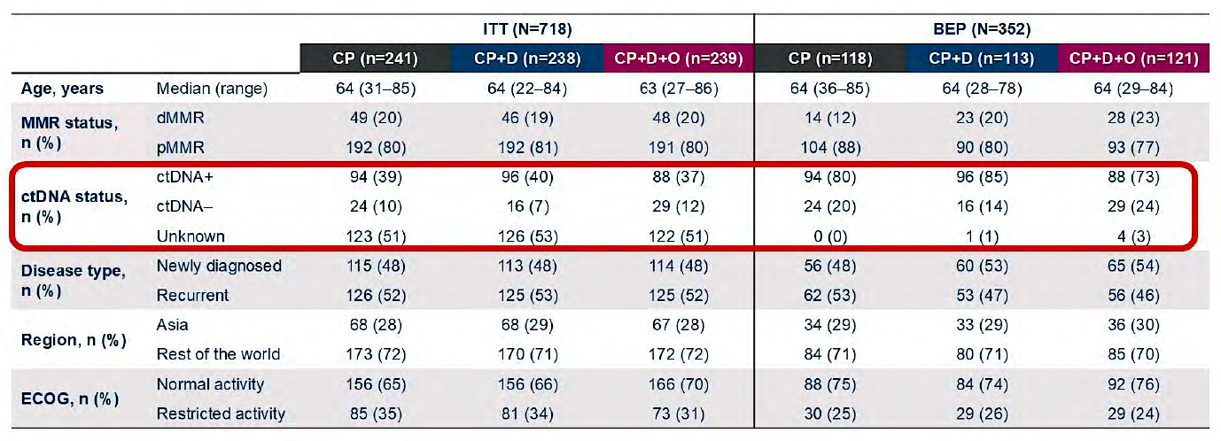
ctDNA Analysis in DUO-E: Baseline Characteristics
Westin S et al. ASCO 2025;Abstract 5512.

Slide 89
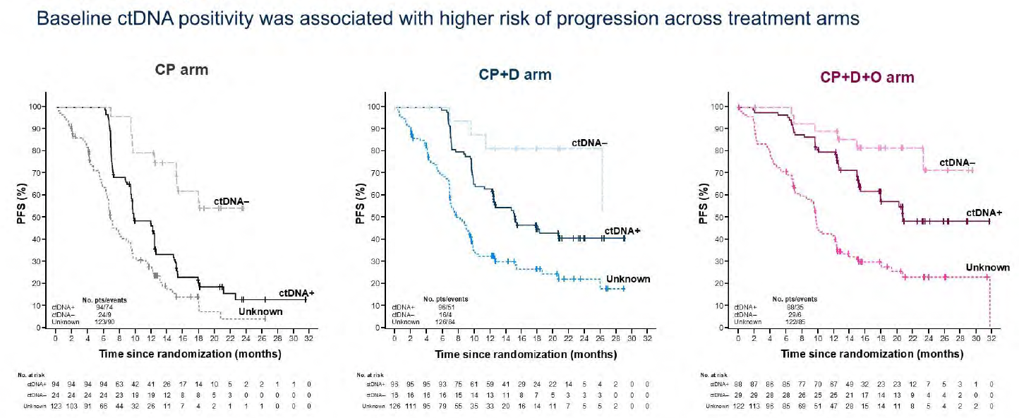
ctDNA Analysis in DUO-E: PFS by ctDNA status in ITT Population
Westin S et al. ASCO 2025;Abstract 5512.

Slide 90
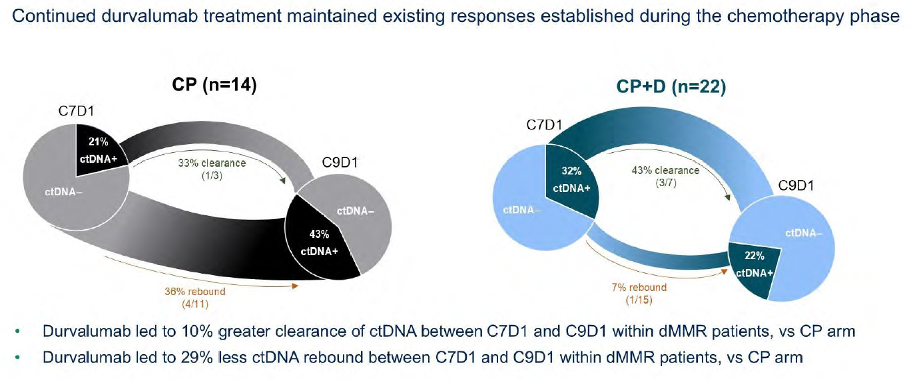
ctDNA Analysis in DUO-E: Durvalumab-Mediated ctDNA Changes During Maintenance Phase (C7D1-C9D1) in Patients with dMMR Disease
Westin S et al. ASCO 2025;Abstract 5512.

Slide 91
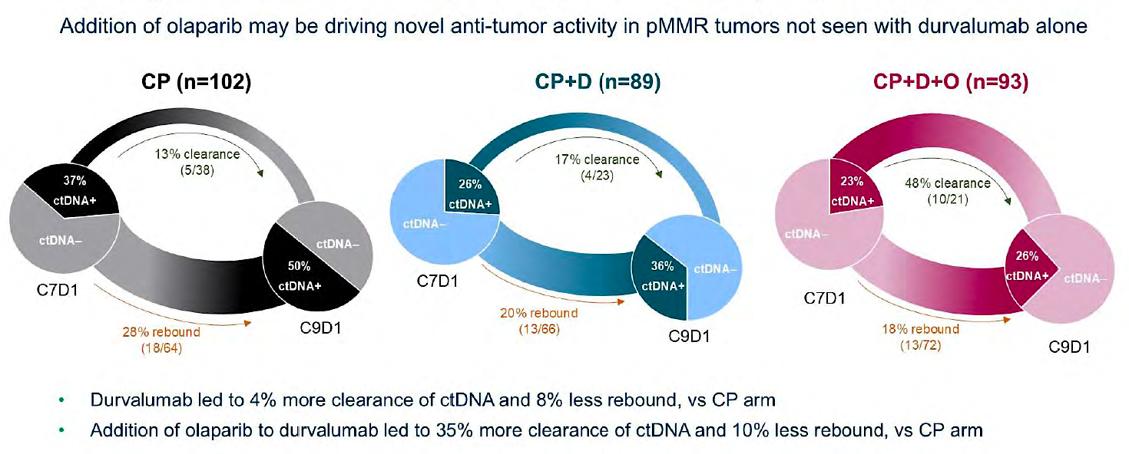
ctDNA Analysis in DUO-E: Durvalumab/Olaparib-Mediated ctDNA Changes During Maintenance Phase in Patients with pMMR Disease
Westin S et al. ASCO 2025;Abstract 5512.

Slide 92
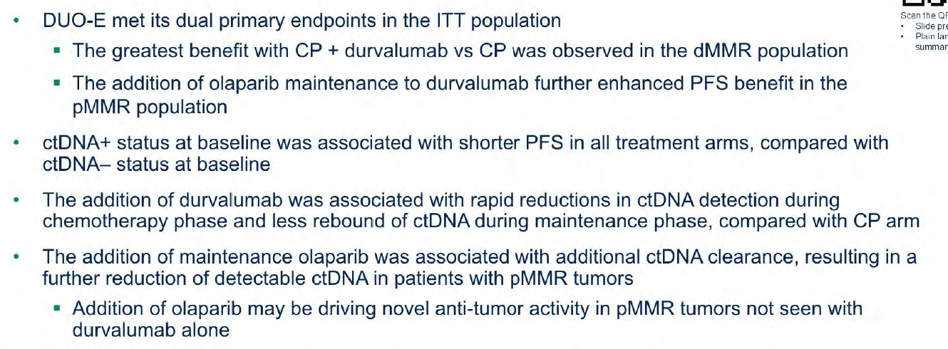
ctDNA Analysis in DUO-E: Author’s Conclusions
Westin S et al. ASCO 2025;Abstract 5512.

Slide 93
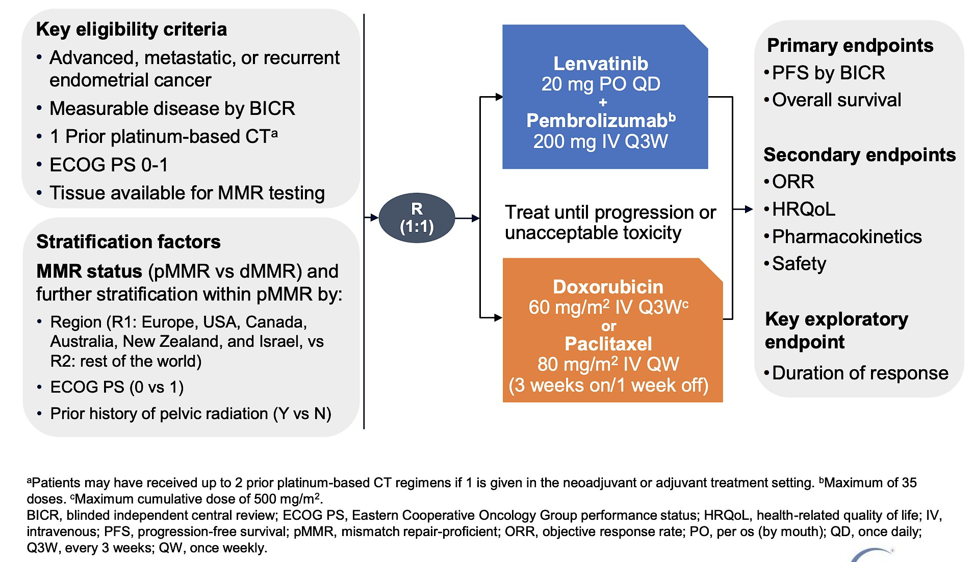
Phase III KEYNOTE-775 Study Design
Makker V et al. SGO 2021.

Slide 94

Phase III KEYNOTE-775: Progression-Free Survival
pMMR Population
All-Comer Population
Makker V et al. J Clin Oncol 2023 June 1;41(16):2904-10.

Slide 95
Phase III KEYNOTE-775: Overall Survival
pMMR Population
All-Comer Population
Makker V et al. J Clin Oncol 2023 June 1;41(16):2904-10.

Slide 96

Phase III KEYNOTE-775: Safety
TEAEs = treatment-emergent adverse events; AEOSIs = adverse events of special interest; CSAEs = clinically significant adverse events
Makker V et al. J Clin Oncol 2023 June 1;41(16):2904-10.

Slide 97
Lenvatinib plus Pembrolizumab (L + P) vs Treatment of Physician’s Choice (TPC) for Advanced Endometrial Cancer (EC): 5-Year Outcomes from Study 309/ KEYNOTE-775
Makker V et al.
ESMO 2025;Abstract 1119P.
POSTER SESSION 1 | SATURDAY, OCTOBER 18

Slide 98
First-Line Lenvatinib + Pembrolizumab (L + P) vs Chemotherapy (CT) for Advanced or Recurrent Endometrial Cancer (EC): Additional 1-Year Follow-Up Results from ENGOT-en9/LEAP-001
Marth C et al.
ESMO 2025;Abstract 1114P.
POSTER SESSION 1 | SATURDAY, OCTOBER 18

Slide 99
Management of Metastatic Endometrial Cancer
Introduction: A pan-tumor perspective on MSI-high disease — Immunotherapy for localized disease
Case 1: Dr Peles – 60-year-old woman
Case 2: Dr Divers – 64-year-old woman
Data Review: Immune Checkpoint Inhibitors
Case 3: Dr Schneider – 32-year-old woman
Case 4: Dr Zafar – 82-year-old woman
Case 5: Dr Willmott – 67-year-old woman
Data Review: HER2-Targeted Treatment
Case 6: Dr Giffi – 73-year-old woman
Case 7: Dr ElSahwi – 68-year-old woman
Data Review: Autoimmune Toxicity with Immunotherapy
Data Review: Novel Antibody-Drug Conjugates

Slide 100
Case Presentation: 32-year-old woman with metastatic recurrence of pMMR endometrial carcinoma has partial response to carboplatin/paclitaxel/pembrolizumab
Dr Kellie Schneider (Charlotte, North Carolina)

Slide 101
Management of Metastatic Endometrial Cancer
Introduction: A pan-tumor perspective on MSI-high disease — Immunotherapy for localized disease
Case 1: Dr Peles – 60-year-old woman
Case 2: Dr Divers – 64-year-old woman
Data Review: Immune Checkpoint Inhibitors
Case 3: Dr Schneider – 32-year-old woman
Case 4: Dr Zafar – 82-year-old woman
Case 5: Dr Willmott – 67-year-old woman
Data Review: HER2-Targeted Treatment
Case 6: Dr Giffi – 73-year-old woman
Case 7: Dr ElSahwi – 68-year-old woman
Data Review: Autoimmune Toxicity with Immunotherapy
Data Review: Novel Antibody-Drug Conjugates

Slide 102
Case Presentation: 82-year-old woman with recurrent MSS endometrial carcinoma s/p chemotherapy receives pembrolizumab/lenvatinib
Dr Syed Zafar (Fort Myers, Florida)

Slide 103
Management of Metastatic Endometrial Cancer
Introduction: A pan-tumor perspective on MSI-high disease — Immunotherapy for localized disease
Case 1: Dr Peles – 60-year-old woman
Case 2: Dr Divers – 64-year-old woman
Data Review: Immune Checkpoint Inhibitors
Case 3: Dr Schneider – 32-year-old woman
Case 4: Dr Zafar – 82-year-old woman
Case 5: Dr Willmott – 67-year-old woman
Data Review: HER2-Targeted Treatment
Case 6: Dr Giffi – 73-year-old woman
Case 7: Dr ElSahwi – 68-year-old woman
Data Review: Autoimmune Toxicity with Immunotherapy
Data Review: Novel Antibody-Drug Conjugates

Slide 104
Case Presentation: 67-year-old woman with HER2-positive metastatic uterine serous carcinoma with progression after carboplatin/paclitaxel/trastuzumab → trastuzumab maintenance receives trastuzumab deruxtecan
FPO
Dr Lyndsay Willmott (Phoenix, Arizona)

Slide 105
Management of Metastatic Endometrial Cancer
Introduction: A pan-tumor perspective on MSI-high disease — Immunotherapy for localized disease
Case 1: Dr Peles – 60-year-old woman
Case 2: Dr Divers – 64-year-old woman
Data Review: Immune Checkpoint Inhibitors
Case 3: Dr Schneider – 32-year-old woman
Case 4: Dr Zafar – 82-year-old woman
Case 5: Dr Willmott – 67-year-old woman
Data Review: HER2-Targeted Treatment
Case 6: Dr Giffi – 73-year-old woman
Case 7: Dr ElSahwi – 68-year-old woman
Data Review: Autoimmune Toxicity with Immunotherapy
Data Review: Novel Antibody-Drug Conjugates

Slide 106

NRG-GY026: An Ongoing Phase II/III Trial of Paclitaxel/Carboplatin Alone or with Either Trastuzumab or Trastuzumab/Pertuzumab for HER2-Positive Endometrial Cancer
Courtesy of Matthew A Powell, MD

Slide 107

J Clin Oncol 2024;42(1):47-58.

Slide 108


DESTINY-PanTumor02: A Phase II Trial of Trastuzumab Deruxtecan for Patients with HER2-Expressing Solid Tumors
ORR = objective response rate
Meric-Bernstam F et al. J Clin Oncol 2024;42(1):47-58.

Slide 109




DESTINY-PanTumor02: Survival
Endometrial
Cervical
Ovarian
PFS
OS
Meric-Bernstam F et al. J Clin Oncol 2024;42(1):47-58.

Slide 110
DESTINY-PanTumor02: Response by HER2 Expression Level (Central)
Endometrial cancer
Ovarian cancer
Cervical cancer
Confirmed ORR by INV (%)
IHC Unknown
IHC 3+
IHC 2+
IHC 1+
IHC 0
IHC 3+
IHC 2+
IHC 1+
IHC 0
IHC 3+
IHC 2+
IHC 1+
IHC 0
All
All
All
Total n in subgroup 40 13 7 4 5 1 40 8 20 8 4 40 11 19 5 5
n of responders 23 11 8 1 3 0 20 6 8 4 2 18 7 7 1 3
Median DOR, months NR NR 18.2 NR 9.9 – 14.2 NR 3.8 14.2 NR 11.3 22.1 11.3 8.3 4.5
95% CR 9.9, 9.6, 3.0, – 2.8, – 4.1, 9.3, 2.8, 8.3, 6.8, 4.4, 4.2, 2.8, – 2.6,
NE NE NE NE NE NE NE NE NE 22.1 NE NE NE
INV = investigator; NR = not reached; NE = not estimable Lee J-Y et al. International Gynecologic Cancer Society (IGCS) 2023; Makker V et al. SGO 2024.
Notes:
Trastuzumab deruxtecan (T-DXd) has demonstrated significant survival benefit for patients with HER2-expressing breast and gastric cancers. In DESTINY-PanTumor02, T-DXd demonstrated clinically meaningful response rates, progression-free survival (PFS), and overall survival (OS) in HER2-expressing tumors.
Methods
This open-label, Phase 2 study (NCT04482309) evaluated T-DXd (5.4 mg/kg Q3W) in patients across seven cohorts with HER2-expressing (immunohistochemistry [IHC] 3+/2+ by local [with retrospective central testing] or central testing) locally advanced/metastatic disease after ≥1 systemic treatment, or without alternative treatment. The primary endpoint was investigator-assessed confirmed objective response rate (ORR). Secondary endpoints included duration of response, PFS, OS, and safety. Exploratory endpoints included pharmacodynamic biomarkers.
Results
At data cutoff (June 2023), 120 patients in the endometrial, cervical, and ovarian cancer cohorts had received treatment (median follow-up [range]: 19.94 [0.8–31.1], 12.60 [0.9–31.0], and 13.13 [0.7–30.6] months, respectively). Overall, 80.8% received ≥2 prior lines of therapy. Table 1 shows efficacy outcomes by HER2 expression levels by cohort. Table 2 shows ORR by HER2 in situ hybridization (ISH) amplification and plasma HER2 amplification by cohort. Grade (G)≥3 drug-related adverse events occurred in 54/120 (45.0%) patients; adjudicated treatment-related interstitial lung disease/pneumonitis occurred in 13/120 (10.8%) patients (n=12 G≤2; n=1 G5).
Conclusion/Implications
T-DXd demonstrated clinically meaningful benefit, including responses across HER2 expression levels and in ISH+ or plasma ERBB2 amplified subgroups, and encouraging survival outcomes in patients with gynecological tumors. Safety was consistent with the known profile. These data support T-DXd as a potential treatment for patients with gynecological HER2-expressing tumors who progressed on prior therapy.
Lee J-Y, Makker V, Manso L, et al. Efficacy and safety of trastuzumab deruxtecan in patients with HER2-expressing solid tumors: results from the cervical, endometrial, and ovarian cancer cohorts of the DESTINY-PanTumor02 study. Presented at: Annual Global Meeting of the International Gynecological Cancer Society 2023; November 5-7, 2023; Seoul, North Korea.
https://cslide.ctimeetingtech.com/igcs23/attendee/confcal/session/calendar?q=makker
Slide courtesy D. O’Malley

Slide 111

DESTINY-PanTumor02: Adverse Events
Adjudicated drug-related events of interstitial lung disease (ILD)/pneumonitis: 28 patients overall (10.5%)
Majority were low grade (grade 1, n = 7 [2.6%]; grade 2, n = 17 [6.4%]), but there were 3 fatal adjudicated drug-related cases of ILD/pneumonitis, one each in the biliary tract, endometrial and other tumors cohorts
Meric-Bernstam F et al. J Clin Oncol 2024;42(1):47-58.

Slide 112
DESTINY-Endometrial01/ GOG-3098/ ENGOT-EN24: A Phase III Study of Trastuzumab Deruxtecan Plus Rilvegostomig or Pembrolizumab as First-Line Treatment of HER2-Expressing (IHC 3+/2+), Mismatch Repair Proficient (pMMR) Endometrial Cancer
Patient Population
IHC 3+ 25%; IHC 2+ 75% (capped)
Endpoints
A: Trastuzumab deruxtecan 5.4 mg/kg + Rilvegostomig 750mg Q3Wª
HER2 expressing (IHC 3+/2+) EC by central test
pMMR EC by central test
Stage III, Stage IV, or recurrent, histologically-confirmed endometrial cancer
Stage III must have measurable disease
Any histological subtype except for sarcomas
May have received 1 prior line of adjuvant/ neoadjuvant chemotherapy (chemotherapy and/or chemoradiation) if recurrence ≥ 6 months after last dose of chemo
No prior exposure to ADCs or ICIs
ECOG PS 0 or 1
N=600
Primary:
PFS (BICR) in ITT
Secondary:
OS (key secondary endpoint)
PFS (Investigator)
ORR
PFS2
HRQoL
R
1:1:1
B: Trastuzumab deruxtecan 5.4 mg/kg + Pembrolizumab 200mg Q3Wª
C: Carboplatin/Paclitaxel + Pembrolizumab^{a,b}
Stratification factors:
HER2 IHC 3+ vs 2+
PD-L1 TAP ≥1% vs TAP <1%
Asia vs Non-Asia
ª Treatment will continue until objective disease progression according to RECIST v1.1 as assessed by the Investigator and confirmed by BICR or until other discontinuation criterion is met, whichever occurs first.
^{b} Carboplatin AUC5, paclitaxel 175 mg/m2, and pembrolizumab 200 mg IV once Q3W x 6 cycles*, followed by maintenance with pembrolizumab 400 mg IV Q6W. Treatment with pembrolizumab will continue for up to 20 total cycles (approximately 24 months, accounting for combination and maintenance phases) or until other discontinuation criteria is met, whichever occurs first.
* At the discretion of the treating Investigator, participants may continue to receive carboplatin, paclitaxel and pembrolizumab Q3W for up to 10 cycles.
Slide Courtesy of David M O’Malley, MD

Slide 113
A Randomized Phase 3 Study of First-Line (1L) Trastuzumab Deruxtecan (T-DXd) with Rilvegostomig or Pembrolizumab in Patients with HER2-Expressing, Mismatch Repair-Proficient (pMMR), Primary Advanced or Recurrent Endometrial Cancer (EC): DESTINY-Endometrial01/GOG-3098/ENGOT-EN24
Slomovitz BM et al.
ESMO 2025;Abstract 1223TiP.
POSTER SESSION 1 | SATURDAY, OCTOBER 18

Slide 114
Management of Metastatic Endometrial Cancer
Introduction: A pan-tumor perspective on MSI-high disease — Immunotherapy for localized disease
Case 1: Dr Peles – 60-year-old woman
Case 2: Dr Divers – 64-year-old woman
Data Review: Immune Checkpoint Inhibitors
Case 3: Dr Schneider – 32-year-old woman
Case 4: Dr Zafar – 82-year-old woman
Case 5: Dr Willmott – 67-year-old woman
Data Review: HER2-Targeted Treatment
Case 6: Dr Giffi – 73-year-old woman
Case 7: Dr ElSahwi – 68-year-old woman
Data Review: Autoimmune Toxicity with Immunotherapy
Data Review: Novel Antibody-Drug Conjugates

Slide 115
Case Presentation: 73-year-old woman with MSS metastatic endometrial carcinoma has disease progression after multiple regimens, including IO/chemotherapy with carboplatin/ gemcitabine/pembrolizumab; biopsy: weak to moderate ER staining, FGFR and PIK3CA mutations
Dr Victoria Giffi (Hagerstown, Maryland)

Slide 116
Management of Metastatic Endometrial Cancer
Introduction: A pan-tumor perspective on MSI-high disease — Immunotherapy for localized disease
Case 1: Dr Peles – 60-year-old woman
Case 2: Dr Divers – 64-year-old woman
Data Review: Immune Checkpoint Inhibitors
Case 3: Dr Schneider – 32-year-old woman
Case 4: Dr Zafar – 82-year-old woman
Case 5: Dr Willmott – 67-year-old woman
Data Review: HER2-Targeted Treatment
Case 6: Dr Giffi – 73-year-old woman
Case 7: Dr ElSahwi – 68-year-old woman
Data Review: Autoimmune Toxicity with Immunotherapy
Data Review: Novel Antibody-Drug Conjugates

Slide 117
Case Presentation: 68-year-old woman with dMMR metastatic endometrial carcinoma receives carboplatin/paclitaxel/ pembrolizumab and develops pericarditis
Dr Karim ElSahwi (Neptune City, New Jersey)

Slide 118
Management of Metastatic Endometrial Cancer
Introduction: A pan-tumor perspective on MSI-high disease — Immunotherapy for localized disease
Case 1: Dr Peles – 60-year-old woman
Case 2: Dr Divers – 64-year-old woman
Data Review: Immune Checkpoint Inhibitors
Case 3: Dr Schneider – 32-year-old woman
Case 4: Dr Zafar – 82-year-old woman
Case 5: Dr Willmott – 67-year-old woman
Data Review: HER2-Targeted Treatment
Case 6: Dr Giffi – 73-year-old woman
Case 7: Dr ElSahwi – 68-year-old woman
Data Review: Autoimmune Toxicity with Immunotherapy
Data Review: Novel Antibody-Drug Conjugates

Slide 119

Immune-Related AEs Associated with Checkpoint Inhibitors
Ibis B et al. Front Immunol 2023;14:1197364.

Slide 120
Management of Metastatic Endometrial Cancer
Introduction: A pan-tumor perspective on MSI-high disease — Immunotherapy for localized disease
Case 1: Dr Peles – 60-year-old woman
Case 2: Dr Divers – 64-year-old woman
Data Review: Immune Checkpoint Inhibitors
Case 3: Dr Schneider – 32-year-old woman
Case 4: Dr Zafar – 82-year-old woman
Case 5: Dr Willmott – 67-year-old woman
Data Review: HER2-Targeted Treatment
Case 6: Dr Giffi – 73-year-old woman
Case 7: Dr ElSahwi – 68-year-old woman
Data Review: Autoimmune Toxicity with Immunotherapy
Data Review: Novel Antibody-Drug Conjugates

Slide 121

ADCs
Targeting TROP2
Courtesy of Rebecca A Dent, MD, MSc

Slide 122

KL264-01 Phase II Study Design: Endometrial and Ovarian Cohorts Sacituzumab Tirumotecan (sac-TMT) for Locally Advanced, Refractory Metastatic Solid Tumors
Wang D et al. ESMO 2024;Abstract 715MO.

Slide 123

KL264-01 Phase II: Preliminary Efficacy with Sacituzumab Tirumotecan for Endometrial Cancer
Wang D et al. ESMO 2024;Abstract 715MO.

Slide 124

KL264-01 Phase II: Preliminary Safety with Sacituzumab Tirumotecan for Endometrial Cancer
Wang D et al. ESMO 2024;Abstract 715MO.

Slide 125
Sacituzumab Tirumotecan (Sac-TMT) Monotherapy in Advanced/Metastatic Endometrial Carcinoma (EC): Results from a Phase 1/2 Study (MK-2870-001/KL264-01)
Wang K et al.
ESMO 2025;Abstract 1111P.
POSTER SESSION 1 | SATURDAY, OCTOBER 18

Slide 126
Ongoing Phase III Trials of Sacituzumab Tirumotecan for Endometrial Cancer
Trial identifier | Study population | Treatment arms | Estimated primary completion date
TroFuse-005 (NCT06132958) | After platinum and immunotherapy | Sacituzumab tirumotecan Chemotherapy | January 2028
TroFuse-033 (NCT06952504) | MMR proficient, first line | Pembrolizumab + chemotherapy followed by maintenance: Sacituzumab tirumotecan + pembrolizumab Pembrolizumab | May 2032
www.clinicaltrials.gov. Accessed October 2025.

Slide 127


GSK5733584: A B7-H4-Targeted Antibody-Drug Conjugate
McKean W et al. SGO 2025;Abstract 1124.

Slide 128

GSK5733584: Phase I Study Design
McKean W et al. SGO 2025;Abstract 1124.

Slide 129
Contributing General Medical Oncologists
Stephen “Fred” Divers, MD
American Oncology Network
Hot Springs, Arkansas
Kellie E Schneider, MD
Novant Health Cancer Institute
Charlotte, North Carolina
Karim ElSahwi, MD
Hackensack Meridian Health
Neptune City, New Jersey
Lyndsay J Willmott, MD
Virginia G Piper Cancer Care Network
Phoenix, Arizona
Victoria Giffi, MD
Meritus Medical Center
Hagerstown, Maryland
Syed F Zafar, MD
Florida Cancer Specialists & Research Institute
Fort Myers, Florida
Shachar Peles, MD
Florida Cancer Specialists & Research Institute
Lake Worth, Florida

Slide 130
Practical Perspectives: Experts Review Actual Cases of Patients with HER2-Positive Gastrointestinal Cancers
A CME/MOC-Accredited Live Webinar
Tuesday, October 21, 2025​ 5:00 PM – 6:00 PM ET
Faculty
Tanios Bekaii-Saab, MD
Kristen K Ciombor, MD, MSCI
Moderator
Neil Love, MD

Slide 131
Thank you for joining us! Please take a moment to complete the survey currently up on Zoom. Your feedback is very important to us. The survey will remain open for 5 minutes after the meeting ends. Information on how to obtain CME, ABIM MOC and ABS credit is provided in the Zoom chat room. Attendees will also receive an email in 1 to 3 business days with these instructions.

