Slide 1
What Clinicians Want to Know: First-Line and Maintenance Therapy for Patients with Extensive-Stage Small Cell Lung Cancer
A CME/MOC-Accredited Live Webinar
Tuesday, November 11, 2025 5:00 PM – 6:00 PM ET
Faculty
Luis Paz-Ares, MD, PhD
Misty Dawn Shields, MD, PhD
Moderator
Neil Love, MD

Slide 2

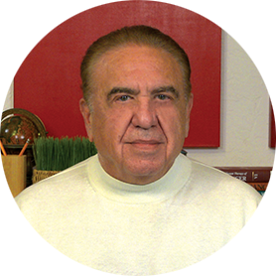

Faculty
Luis Paz-Ares, MD, PhD
Chair of the Medical Oncology Department at the Hospital Universitario 12 de Octubre
Associate Professor at the Universidad Complutense
Head of the Lung Cancer Unit at the National Oncology Research Center
Madrid, Spain
MODERATOR
Neil Love, MD Research To Practice Miami, Florida
Misty Dawn Shields, MD, PhD
Assistant Professor of Clinical Medicine
Indiana University School of Medicine
Adjunct Assistant Professor of Medical and Molecular Genetics
Associate Member, Experimental and Developmental Therapeutics
Department of Medicine, Division of Hematology/Oncology, Thoracic Oncology
Indiana University Melvin and Bren Simon Comprehensive Cancer Center
Indianapolis, Indiana

Slide 3
Commercial Support
This activity is supported by educational grants from Genentech, a member of the Roche Group, and Jazz Pharmaceuticals Inc.

Slide 4
Dr Love — Disclosures
Dr Love is president and CEO of Research To Practice. Research To Practice receives funds in the form of educational grants to develop CME activities from the following companies: Aadi Bioscience, AbbVie Inc, ADC Therapeutics, Agendia Inc, Alexion Pharmaceuticals, Amgen Inc, Array BioPharma Inc, a subsidiary of Pfizer Inc, Arvinas, Astellas, AstraZeneca Pharmaceuticals LP, Aveo Pharmaceuticals, Bayer HealthCare Pharmaceuticals, BeOne, Black Diamond Therapeutics Inc, Blueprint Medicines, Boehringer Ingelheim Pharmaceuticals Inc, Bristol Myers Squibb, Clovis Oncology, Coherus BioSciences, Corcept Therapeutics Inc, CTI BioPharma, a Sobi Company, Daiichi Sankyo Inc, Eisai Inc, Elevation Oncology Inc, Exact Sciences Corporation, Exelixis Inc, Genentech, a member of the Roche Group, Genmab US Inc, Geron Corporation, Gilead Sciences Inc, GSK, Helsinn Therapeutics (US) Inc, Hologic Inc, ImmunoGen Inc, Incyte Corporation, Ipsen Biopharmaceuticals Inc, Jazz Pharmaceuticals Inc, Johnson & Johnson, Karyopharm Therapeutics, Kite, A Gilead Company, Kura Oncology, Legend Biotech, Lilly, MEI Pharma Inc, Merck, Mersana Therapeutics Inc, Mirati Therapeutics Inc, Mural Oncology Inc, Natera Inc, Novartis, Novartis Pharmaceuticals Corporation on behalf of Advanced Accelerator Applications, Novocure Inc, Nuvalent, Pfizer Inc, Pharmacyclics LLC, an AbbVie Company, Puma Biotechnology Inc, Regeneron Pharmaceuticals Inc, Rigel Pharmaceuticals Inc, R-Pharm US, Sanofi, Seagen Inc, Servier Pharmaceuticals LLC, SpringWorks Therapeutics Inc, Stemline Therapeutics Inc, Sumitomo Pharma America, Syndax Pharmaceuticals, Taiho Oncology Inc, Takeda Pharmaceuticals USA Inc, TerSera Therapeutics LLC, and Tesaro, A GSK Company.

Slide 5
Research To Practice CME Planning Committee Members, Staff and Reviewers
Planners, scientific staff and independent reviewers for Research To Practice have no relevant conflicts of interest to disclose.

Slide 6
Dr Paz-Ares — Disclosures
Advisory Committees | AstraZeneca Pharmaceuticals LP, Bristol Myers Squibb, MSD
Founder and Board Member | Altum Sequencing, STAb Therapeutics
Speakers Bureaus | AbbVie Inc, Amgen Inc, AstraZeneca Pharmaceuticals LP, Bayer HealthCare Pharmaceuticals, BeOne, BioNTech SE, Boehringer Ingelheim Pharmaceuticals Inc, Bristol Myers Squibb, Daiichi Sankyo Inc, Genmab US Inc, Ipsen Biopharmaceuticals Inc, Janssen Biotech Inc, Jazz Pharmaceuticals Inc, Johnson & Johnson, Lilly, Merck, Mirati Therapeutics Inc, Moderna, MSD, Novartis, Pfizer Inc, PharmaMar, RayzeBio Inc, Regeneron Pharmaceuticals Inc, Roche Laboratories Inc

Slide 7
Dr Shields — Disclosures
Steering Committees | AstraZeneca Pharmaceuticals LP

Slide 8
This educational activity contains discussion of non-FDA-approved uses of agents and regimens. Please refer to official prescribing information for each product for approved indications.

Slide 9
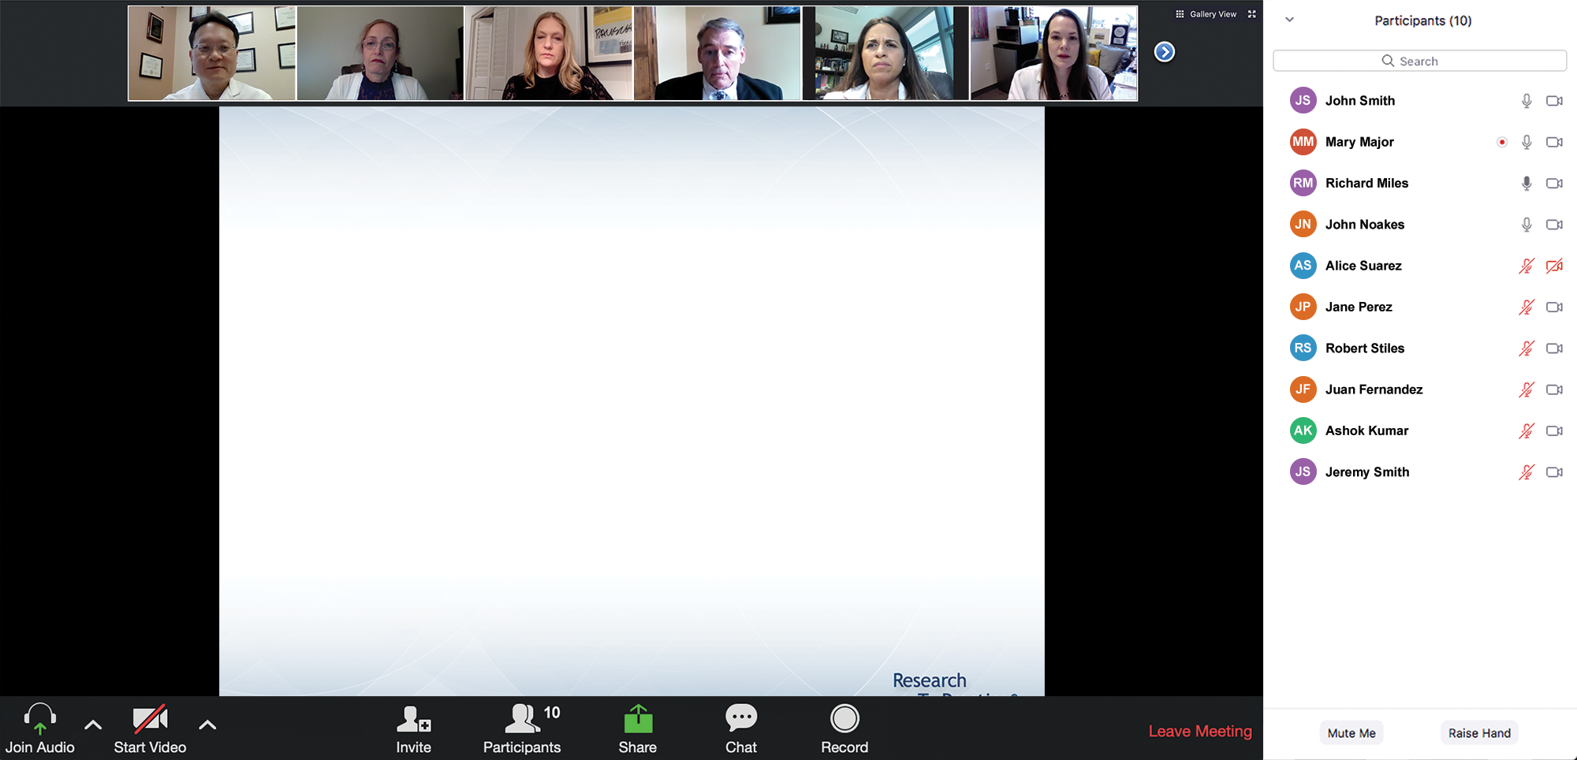
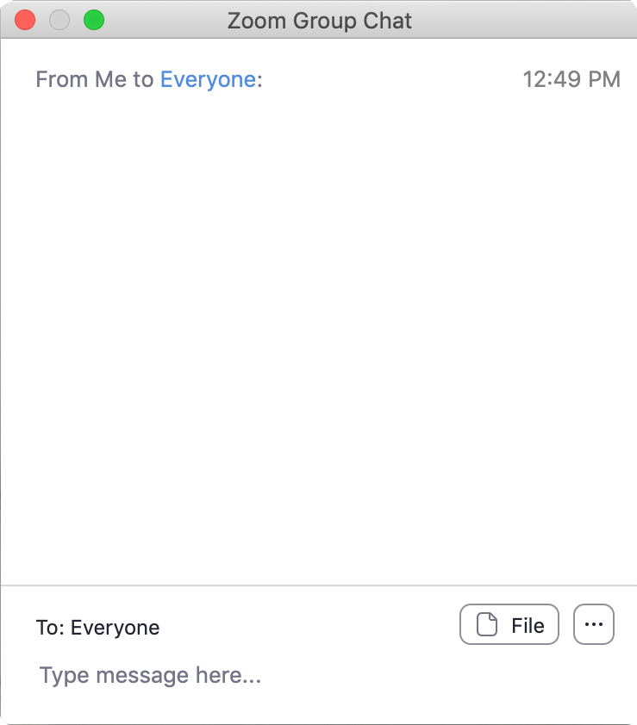
We Encourage Clinicians in Practice to Submit Questions
Feel free to submit questions now before the program begins and throughout the program.

Slide 10
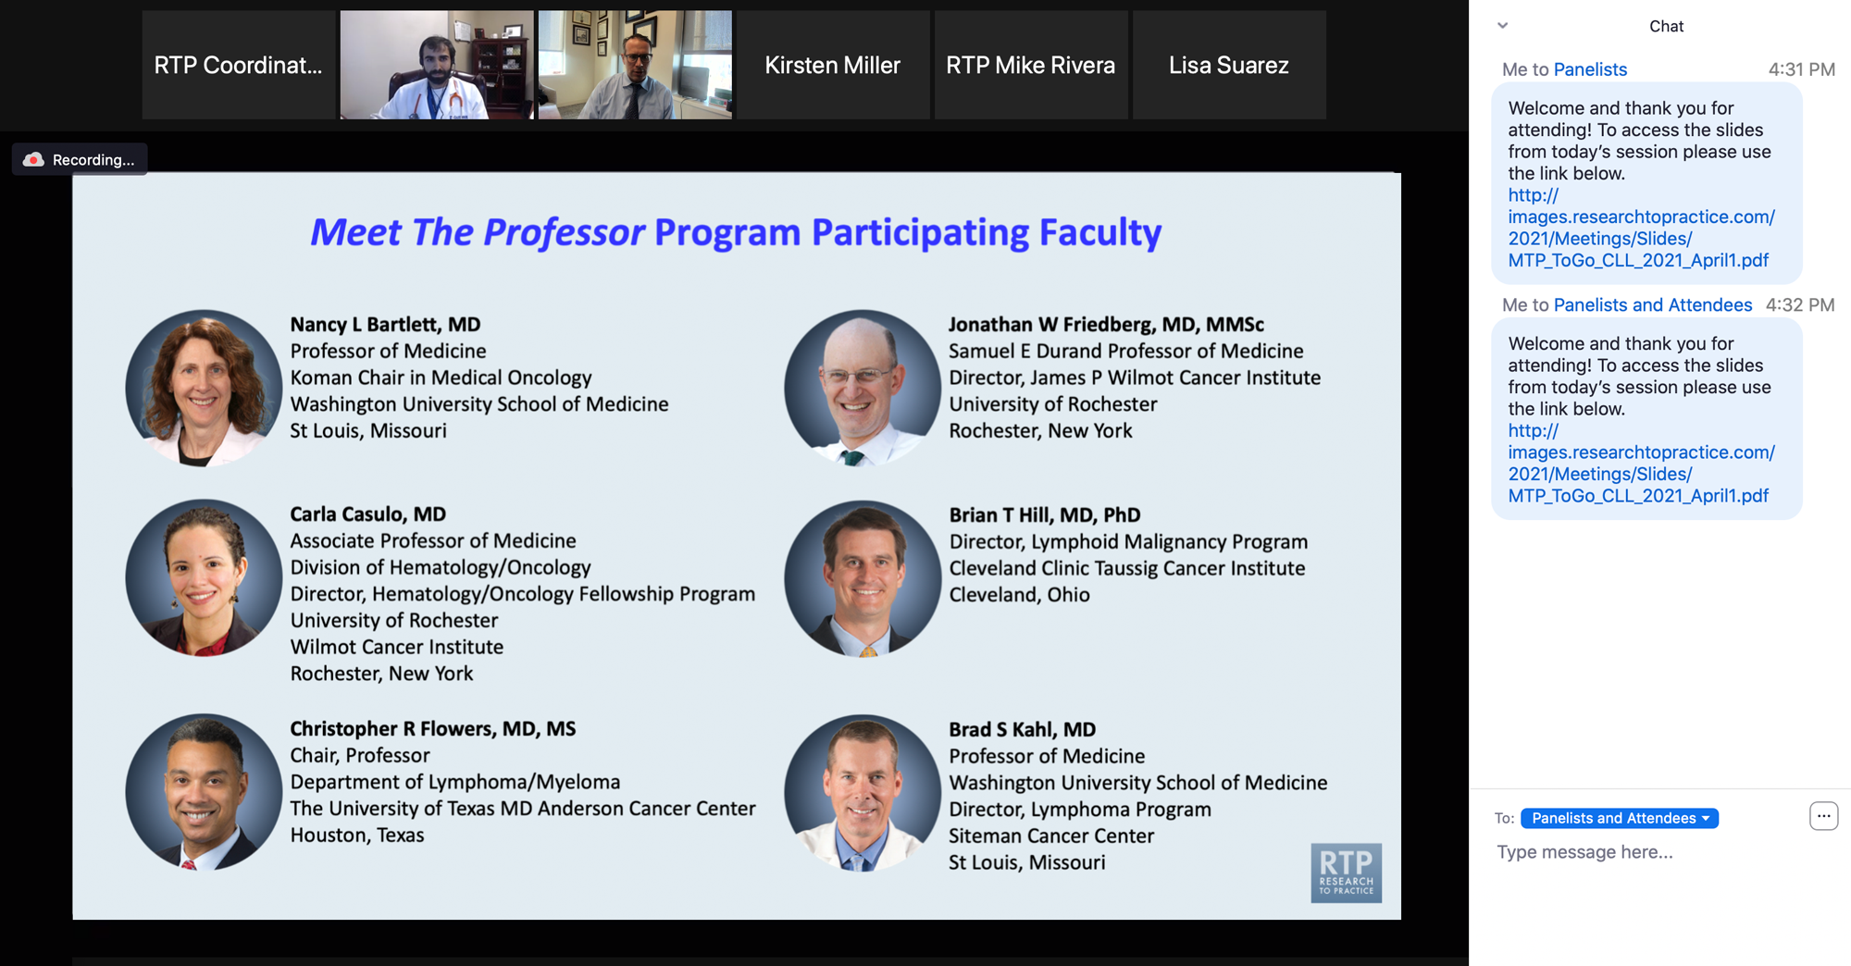
Familiarizing Yourself with the Zoom Interface
Expand chat submission box
Drag the white line above the submission box up to create more space for your message.

Slide 11
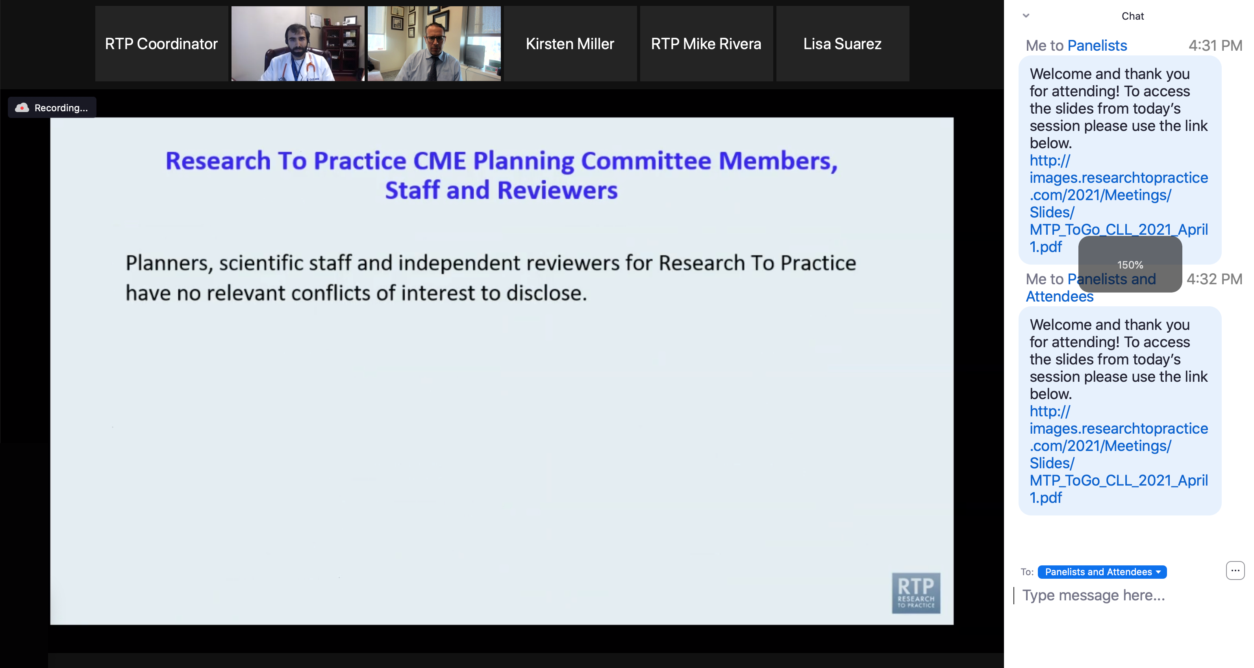
Familiarizing Yourself with the Zoom Interface
Increase chat font size
Press Command (for Mac) or Control (for PC) and the + symbol. You may do this as many times as you need for readability.

Slide 12
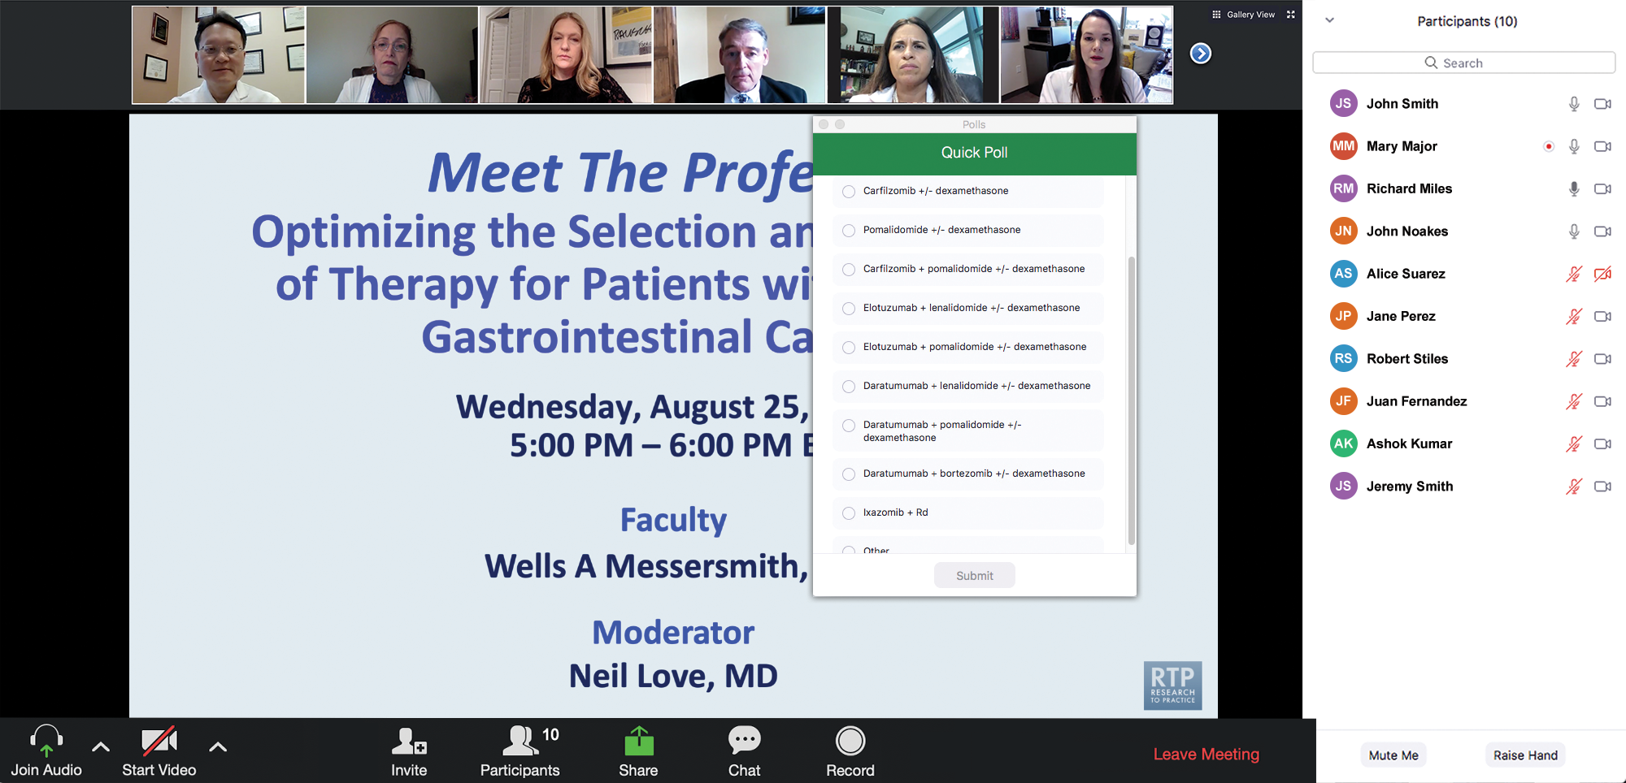
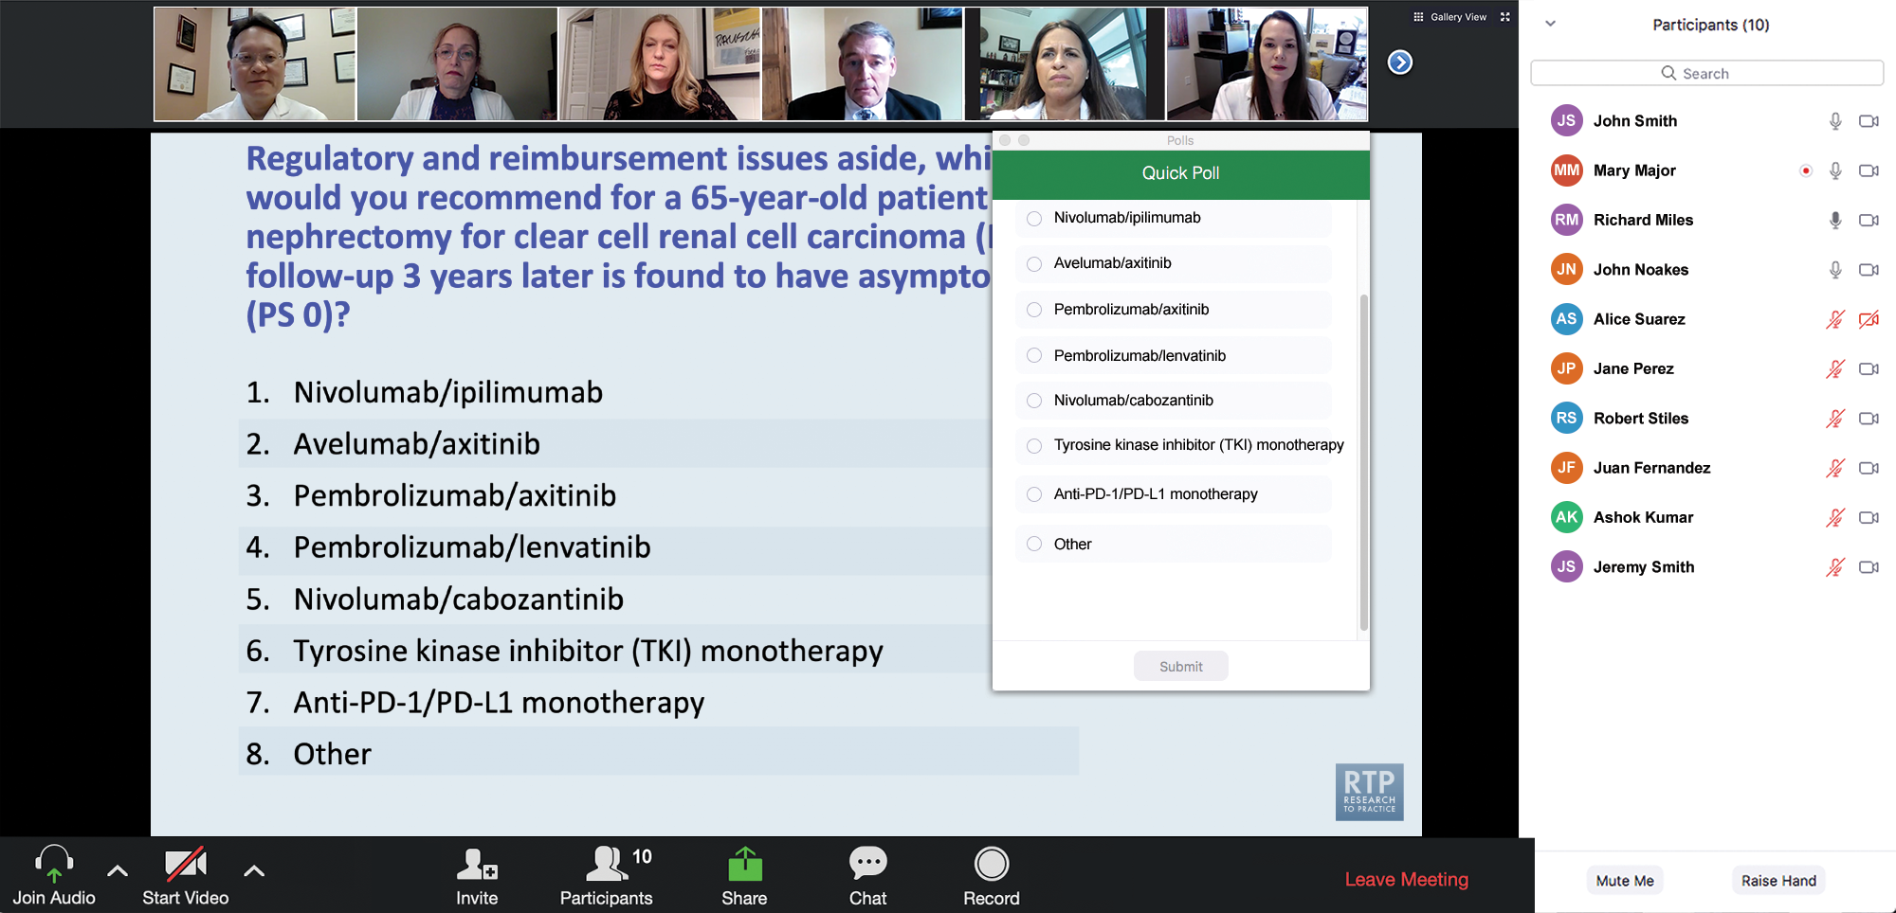
Clinicians in the Audience, Please Complete the Pre- and Postmeeting Surveys
Quick Survey
Quick Poll

Slide 13
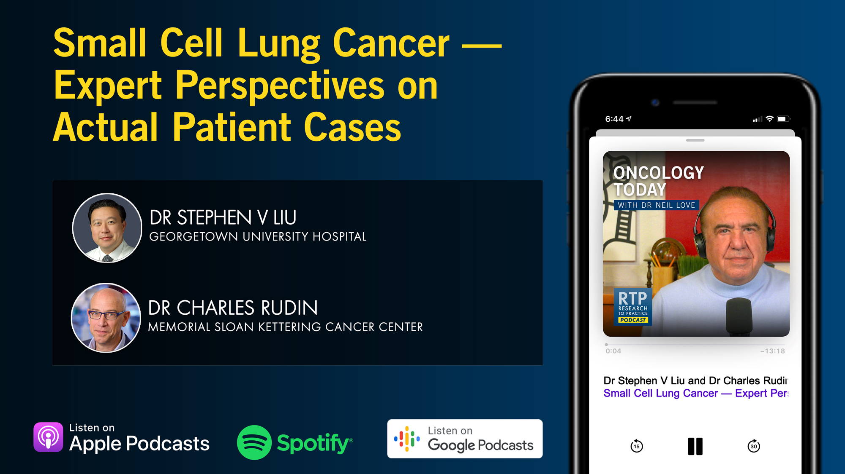

Slide 14
Cancer Q&A: Understanding the Role and Reality of CAR (Chimeric Antigen Receptor) T-Cell Therapy for Non-Hodgkin Lymphoma
A CME/MOC-Accredited Webinar Developed in Partnership with CancerCare®
Wednesday, November 12, 2025 5:00 PM – 6:00 PM ET
Faculty
Jeremy S Abramson, MD, MMSc
Loretta J Nastoupil, MD
Moderator
Neil Love, MD

Slide 15
Cancer Conference Update: 2025 ESMO Annual Meeting — Breast Cancer Highlights
CME/MOC-Accredited Live Webinar
Thursday, November 13, 2025​ 5:00 PM – 6:30 PM ET
Faculty
Professor Giuseppe Curigliano, MD, PhD
Priyanka Sharma, MD
Moderator
Neil Love, MD

Slide 16
Practical Perspectives: Clinical Investigators Review Actual Cases of Patients with Advanced Gastroesophageal Cancers
A CME/MOC-Accredited Live Webinar
Tuesday, November 18, 2025 5:00 PM – 6:00 PM ET
Faculty
Yelena Y Janjigian, MD
Moderator
Neil Love, MD

Slide 17
Preventing and Managing Toxicities Associated with Antibody-Drug Conjugates in the Management of Metastatic Breast Cancer
A CME/MOC-Accredited Live Webinar
Wednesday, November 19, 2025 5:00 PM – 6:00 PM ET
Faculty
Lisa A Carey, MD, ScM, FASCO
Rita Nanda, MD
Moderator
Neil Love, MD

Slide 18
Exciting CME Events You Do Not Want to Miss
A Friday Satellite Symposium Series Preceding the 67th ASH Annual Meeting
Friday, December 5, 2025
Acute Myeloid Leukemia
7:30 AM – 9:30 AM ET
Myelofibrosis and Systemic Mastocytosis
3:15 PM – 5:15 PM ET
Chronic Lymphocytic Leukemia
11:30 AM – 1:30 PM ET
Follicular Lymphoma and
Diffuse Large B-Cell Lymphoma
7:00 PM – 9:00 PM ET

Slide 19
Cases from the Community: Investigators Discuss the Optimal Management of Breast Cancer
A 3-Part CME Satellite Symposium Series
Antibody-Drug Conjugates for
Metastatic Breast Cancer
Tuesday, December 9, 2025
7:00 PM – 8:30 PM CT
HER2-Positive Breast Cancer
Wednesday, December 10, 2025
7:00 PM – 9:00 PM CT
Endocrine-Based Therapy
Thursday, December 11, 2025
7:00 PM – 9:00 PM CT
Moderator
Neil Love, MD

Slide 20
Grand Rounds
CME/MOC-Accredited Interactive Series
November 2025 to April 2026
Two Series
Optimizing Treatment for Patients with Relapsed/Refractory Chronic Lymphocytic Leukemia
Optimizing the Use of Novel Therapies for Patients with Diffuse Large B-Cell Lymphoma
Host a 1-hour session at your institution: Email Meetings@ResearchToPractice.com or call (800) 233-6153

Slide 21

Save The Date
A Multitumor CME/MOC-, NCPD- and ACPE-Accredited Educational Conference Developed in Partnership with Florida Cancer Specialists & Research Institute
Friday to Sunday, April 24 to 26, 2026
The Ritz-Carlton Orlando, Grande Lakes | Orlando, Florida
Moderated by Neil Love, MD

Slide 22
What Clinicians Want to Know: First-Line and Maintenance Therapy for Patients with Extensive-Stage Small Cell Lung Cancer
A CME/MOC-Accredited Live Webinar
Tuesday, November 11, 2025 5:00 PM – 6:00 PM ET
Faculty
Luis Paz-Ares, MD, PhD
Misty Dawn Shields, MD, PhD
Moderator
Neil Love, MD

Slide 23
Faculty
Luis Paz-Ares, MD, PhD
Chair of the Medical Oncology Department at the Hospital Universitario 12 de Octubre
Associate Professor at the Universidad Complutense
Head of the Lung Cancer Unit at the National Oncology Research Center
Madrid, Spain
MODERATOR
Neil Love, MD Research To Practice Miami, Florida
Misty Dawn Shields, MD, PhD
Assistant Professor of Clinical Medicine
Indiana University School of Medicine
Adjunct Assistant Professor of Medical and Molecular Genetics
Associate Member, Experimental and Developmental Therapeutics
Department of Medicine, Division of Hematology/Oncology, Thoracic Oncology
Indiana University Melvin and Bren Simon Comprehensive Cancer Center
Indianapolis, Indiana

Slide 24
We Encourage Clinicians in Practice to Submit Questions
Feel free to submit questions now before the program begins and throughout the program.

Slide 25
Clinicians in the Audience, Please Complete the Pre- and Postmeeting Surveys
Quick Survey
Quick Poll

Slide 27
Cancer Q&A: Understanding the Role and Reality of CAR (Chimeric Antigen Receptor) T-Cell Therapy for Non-Hodgkin Lymphoma
A CME/MOC-Accredited Webinar Developed in Partnership with CancerCare®
Wednesday, November 12, 2025 5:00 PM – 6:00 PM ET
Faculty
Jeremy S Abramson, MD, MMSc
Loretta J Nastoupil, MD
Moderator
Neil Love, MD

Slide 28
Cancer Conference Update: 2025 ESMO Annual Meeting — Breast Cancer Highlights
CME/MOC-Accredited Live Webinar
Thursday, November 13, 2025​ 5:00 PM – 6:30 PM ET
Faculty
Professor Giuseppe Curigliano, MD, PhD
Priyanka Sharma, MD
Moderator
Neil Love, MD

Slide 29
Practical Perspectives: Clinical Investigators Review Actual Cases of Patients with Advanced Gastroesophageal Cancers
A CME/MOC-Accredited Live Webinar
Tuesday, November 18, 2025 5:00 PM – 6:00 PM ET
Faculty
Yelena Y Janjigian, MD
Moderator
Neil Love, MD

Slide 30
Preventing and Managing Toxicities Associated with Antibody-Drug Conjugates in the Management of Metastatic Breast Cancer
A CME/MOC-Accredited Live Webinar
Wednesday, November 19, 2025 5:00 PM – 6:00 PM ET
Faculty
Lisa A Carey, MD, ScM, FASCO
Rita Nanda, MD
Moderator
Neil Love, MD

Slide 31
Exciting CME Events You Do Not Want to Miss
A Friday Satellite Symposium Series Preceding the 67th ASH Annual Meeting
Friday, December 5, 2025
Acute Myeloid Leukemia
7:30 AM – 9:30 AM ET
Myelofibrosis and Systemic Mastocytosis
3:15 PM – 5:15 PM ET
Chronic Lymphocytic Leukemia
11:30 AM – 1:30 PM ET
Follicular Lymphoma and
Diffuse Large B-Cell Lymphoma
7:00 PM – 9:00 PM ET

Slide 32
Cases from the Community: Investigators Discuss the Optimal Management of Breast Cancer
A 3-Part CME Satellite Symposium Series
Antibody-Drug Conjugates for
Metastatic Breast Cancer
Tuesday, December 9, 2025
7:00 PM – 8:30 PM CT
HER2-Positive Breast Cancer
Wednesday, December 10, 2025
7:00 PM – 9:00 PM CT
Endocrine-Based Therapy
Thursday, December 11, 2025
7:00 PM – 9:00 PM CT
Moderator
Neil Love, MD

Slide 33
Grand Rounds
CME/MOC-Accredited Interactive Series
November 2025 to April 2026
Two Series
Optimizing Treatment for Patients with Relapsed/Refractory Chronic Lymphocytic Leukemia
Optimizing the Use of Novel Therapies for Patients with Diffuse Large B-Cell Lymphoma
Host a 1-hour session at your institution: Email Meetings@ResearchToPractice.com or call (800) 233-6153

Slide 34
Save The Date
A Multitumor CME/MOC-, NCPD- and ACPE-Accredited Educational Conference Developed in Partnership with Florida Cancer Specialists & Research Institute
Friday to Sunday, April 24 to 26, 2026
The Ritz-Carlton Orlando, Grande Lakes | Orlando, Florida
Moderated by Neil Love, MD

Slide 35
RTP Content Distribution Platform 9-28-24 to 9-28-25
Podcast
Streaming Platforms (YouTube, Spotify)
 | Year | Month
Total (hours) | 280 | 24
Recordings | 93 | 7
Webinars | 41 | 4
Cases | 62 | 5
Meetings | 84 | 7
Final | 218 | 18
Email
Social Media
App
Website
Text Messages
QR Code Cards

Slide 36
What Clinicians Want to Know: First-Line and Maintenance Therapy for Patients with Extensive-Stage Small Cell Lung Cancer
A CME/MOC-Accredited Live Webinar
Tuesday, November 11, 2025 5:00 PM – 6:00 PM ET
Faculty
Luis Paz-Ares, MD, PhD
Misty Dawn Shields, MD, PhD
Moderator
Neil Love, MD

Slide 37
Dr Paz-Ares — Disclosures
Advisory Committees | AstraZeneca Pharmaceuticals LP, Bristol Myers Squibb, MSD
Founder and Board Member | Altum Sequencing, STAb Therapeutics
Speakers Bureaus | AbbVie Inc, Amgen Inc, AstraZeneca Pharmaceuticals LP, Bayer HealthCare Pharmaceuticals, BeOne, BioNTech SE, Boehringer Ingelheim Pharmaceuticals Inc, Bristol Myers Squibb, Daiichi Sankyo Inc, Genmab US Inc, Ipsen Biopharmaceuticals Inc, Janssen Biotech Inc, Jazz Pharmaceuticals Inc, Johnson & Johnson, Lilly, Merck, Mirati Therapeutics Inc, Moderna, MSD, Novartis, Pfizer Inc, PharmaMar, RayzeBio Inc, Regeneron Pharmaceuticals Inc, Roche Laboratories Inc

Slide 38
Dr Shields — Disclosures
Steering Committees | AstraZeneca Pharmaceuticals LP

Slide 39
Dr Love — Disclosures
Dr Love is president and CEO of Research To Practice. Research To Practice receives funds in the form of educational grants to develop CME activities from the following companies: Aadi Bioscience, AbbVie Inc, ADC Therapeutics, Agendia Inc, Alexion Pharmaceuticals, Amgen Inc, Array BioPharma Inc, a subsidiary of Pfizer Inc, Arvinas, Astellas, AstraZeneca Pharmaceuticals LP, Aveo Pharmaceuticals, Bayer HealthCare Pharmaceuticals, BeOne, Black Diamond Therapeutics Inc, Blueprint Medicines, Boehringer Ingelheim Pharmaceuticals Inc, Bristol Myers Squibb, Clovis Oncology, Coherus BioSciences, Corcept Therapeutics Inc, CTI BioPharma, a Sobi Company, Daiichi Sankyo Inc, Eisai Inc, Elevation Oncology Inc, Exact Sciences Corporation, Exelixis Inc, Genentech, a member of the Roche Group, Genmab US Inc, Geron Corporation, Gilead Sciences Inc, GSK, Helsinn Therapeutics (US) Inc, Hologic Inc, ImmunoGen Inc, Incyte Corporation, Ipsen Biopharmaceuticals Inc, Jazz Pharmaceuticals Inc, Johnson & Johnson, Karyopharm Therapeutics, Kite, A Gilead Company, Kura Oncology, Legend Biotech, Lilly, MEI Pharma Inc, Merck, Mersana Therapeutics Inc, Mirati Therapeutics Inc, Mural Oncology Inc, Natera Inc, Novartis, Novartis Pharmaceuticals Corporation on behalf of Advanced Accelerator Applications, Novocure Inc, Nuvalent, Pfizer Inc, Pharmacyclics LLC, an AbbVie Company, Puma Biotechnology Inc, Regeneron Pharmaceuticals Inc, Rigel Pharmaceuticals Inc, R-Pharm US, Sanofi, Seagen Inc, Servier Pharmaceuticals LLC, SpringWorks Therapeutics Inc, Stemline Therapeutics Inc, Sumitomo Pharma America, Syndax Pharmaceuticals, Taiho Oncology Inc, Takeda Pharmaceuticals USA Inc, TerSera Therapeutics LLC, and Tesaro, A GSK Company.

Slide 40
Commercial Support
This activity is supported by educational grants from Genentech, a member of the Roche Group, and Jazz Pharmaceuticals Inc.
Research To Practice CME Planning Committee Members, Staff and Reviewers
Planners, scientific staff and independent reviewers for Research To Practice have no relevant conflicts of interest to disclose.

Slide 41
This educational activity contains discussion of non-FDA-approved uses of agents and regimens. Please refer to official prescribing information for each product for approved indications.

Slide 42
What Clinicians Want to Know: First-Line and Maintenance Therapy for Patients with Extensive-Stage Small Cell Lung Cancer Survey of 50 US-Based General Medical Oncologists November 1-10, 2025

Slide 43
Up-Front Treatment of Extensive-Stage Small Cell Lung Cancer
Introduction: Tail on the Curve?
Module 1: First-Line Chemoimmunotherapy
Module 2: Maintenance Lurbinectedin
Module 3: Second-Line Treatment, Tarlatamab
Module 4: Ongoing Research

Slide 44
Up-Front Treatment of Extensive-Stage Small Cell Lung Cancer
Introduction: Tail on the Curve?
Module 1: First-Line Chemoimmunotherapy
Module 2: Maintenance Lurbinectedin
Module 3: Second-Line Treatment, Tarlatamab
Module 4: Ongoing Research

Slide 45
Integrating New Advances into the Care of Patients with Cancer A Multitumor Symposium in Partnership with the American Oncology Network
CME/MOC, NCPD and ACPE Accredited
Saturday, November 8, 2025 10:00 AM – 3:00 PM CT

Slide 46


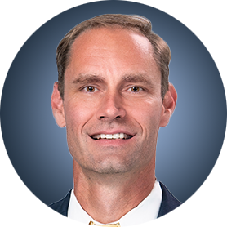
Lung Cancer Faculty
Justin F Gainor, MD
Director, Center for Thoracic Cancers Program
Director of Targeted Immunotherapy in the Henri and Belinda Termeer Center for Targeted Therapies
Massachusetts General Hospital
Associate Professor of Medicine
Harvard Medical School
Boston, Massachusetts
Misty Dawn Shields, MD, PhD
Assistant Professor of Clinical Medicine
Indiana University School of Medicine
Adjunct Assistant Professor of Medical and Molecular Genetics
Associate Member, Experimental and Developmental Therapeutics
Department of Medicine, Division of Hematology/Oncology, Thoracic Oncology
Indiana University Melvin and Bren Simon Comprehensive Cancer Center
Indianapolis, Indiana
Corey J Langer, MD
Director of Thoracic Oncology
Abramson Cancer Center
Professor of Medicine
Perelman School of Medicine
University of Pennsylvania
Philadelphia, Pennsylvania
MODERATOR
Stephen "Fred" Divers, MD
Chief Medical Officer
American Oncology Network
Hot Springs, Arkansas

Slide 47
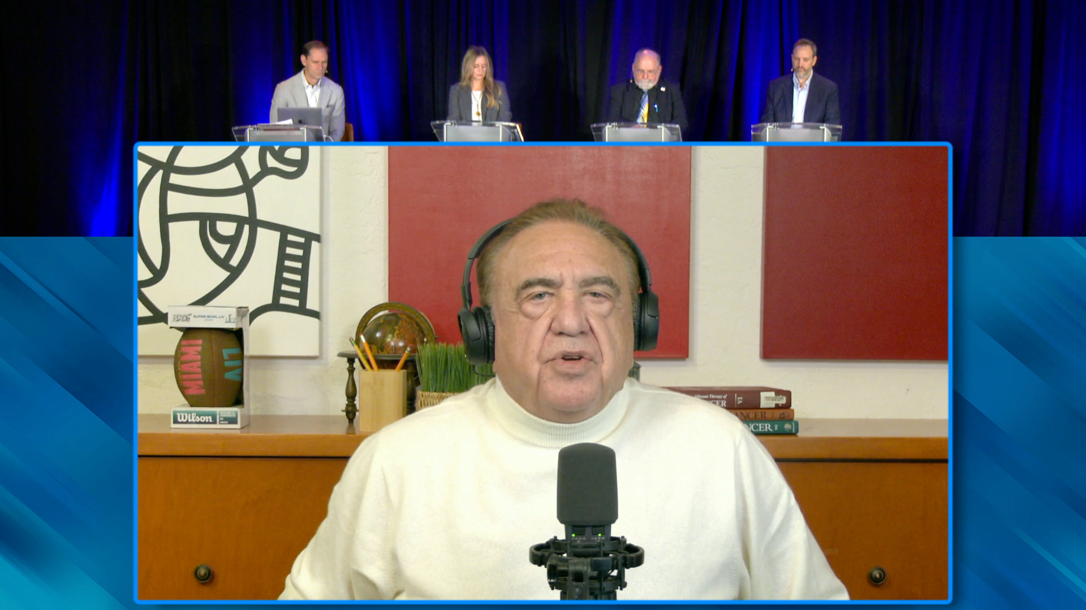
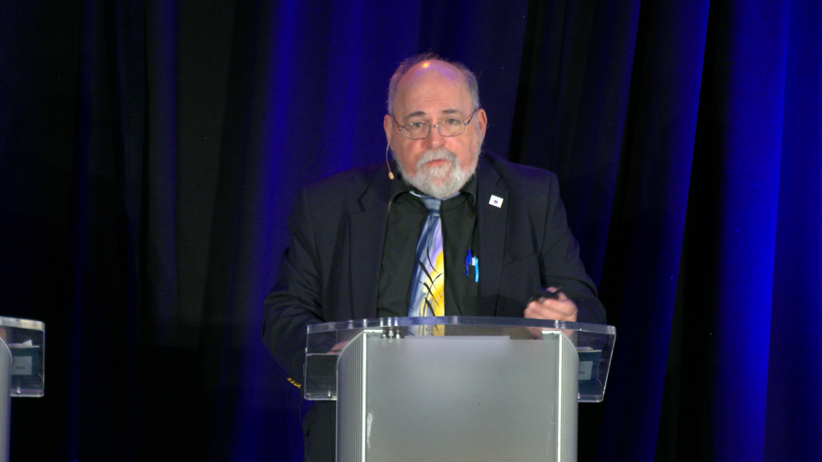

Slide 48
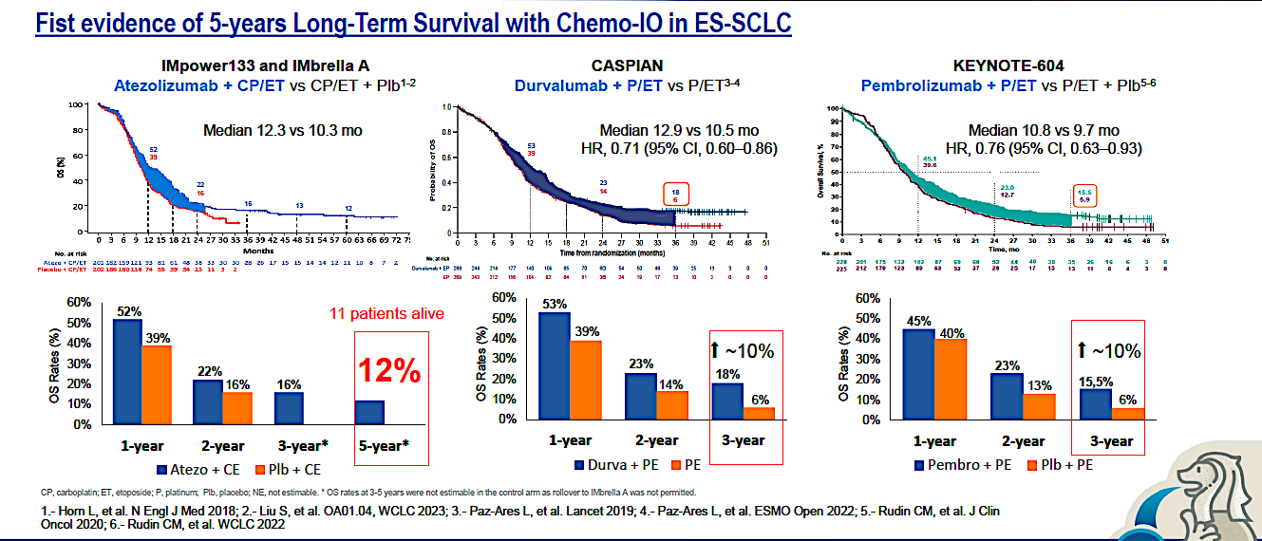
Pivotal Trials of ICIs in ES SCLC – Long term outcome
Courtesy of Corey J Langer, MD

Slide 49
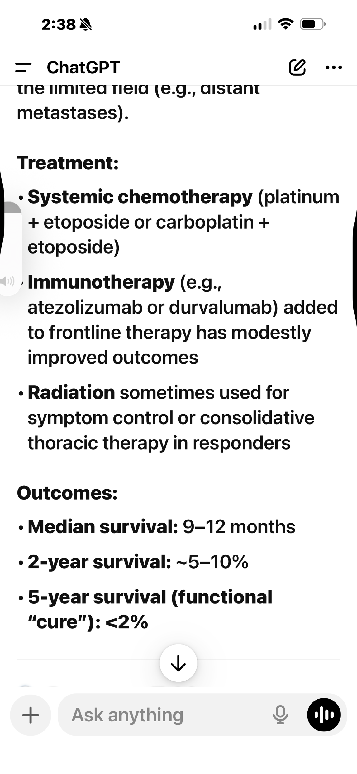

Slide 50
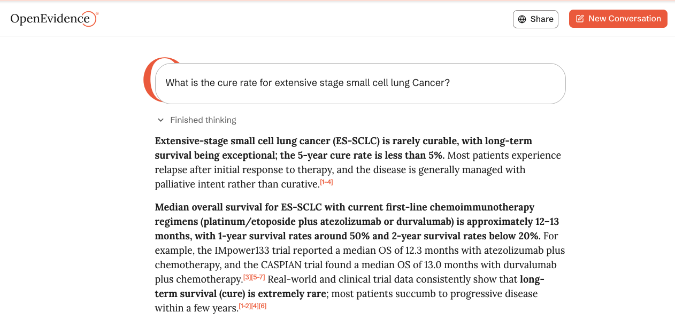

Slide 51
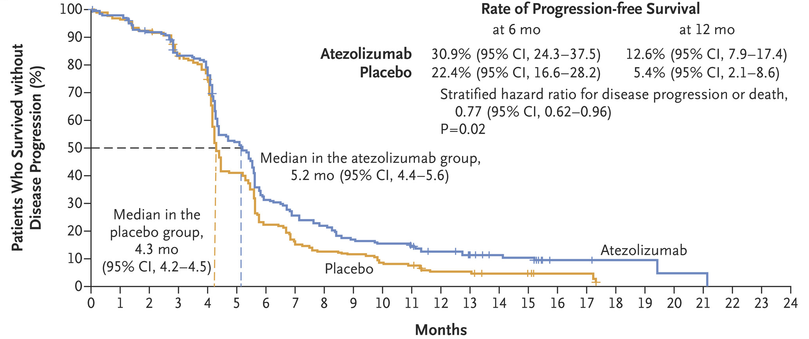
Phase III IMpower133 Trial: Primary Progression-Free Survival with Atezolizumab/Carboplatin/Etoposide (ITT Population)
ITT = intention to treat
Horn L et al. N Engl J Med 2018 December 6;379(23):2220-9.

Slide 52
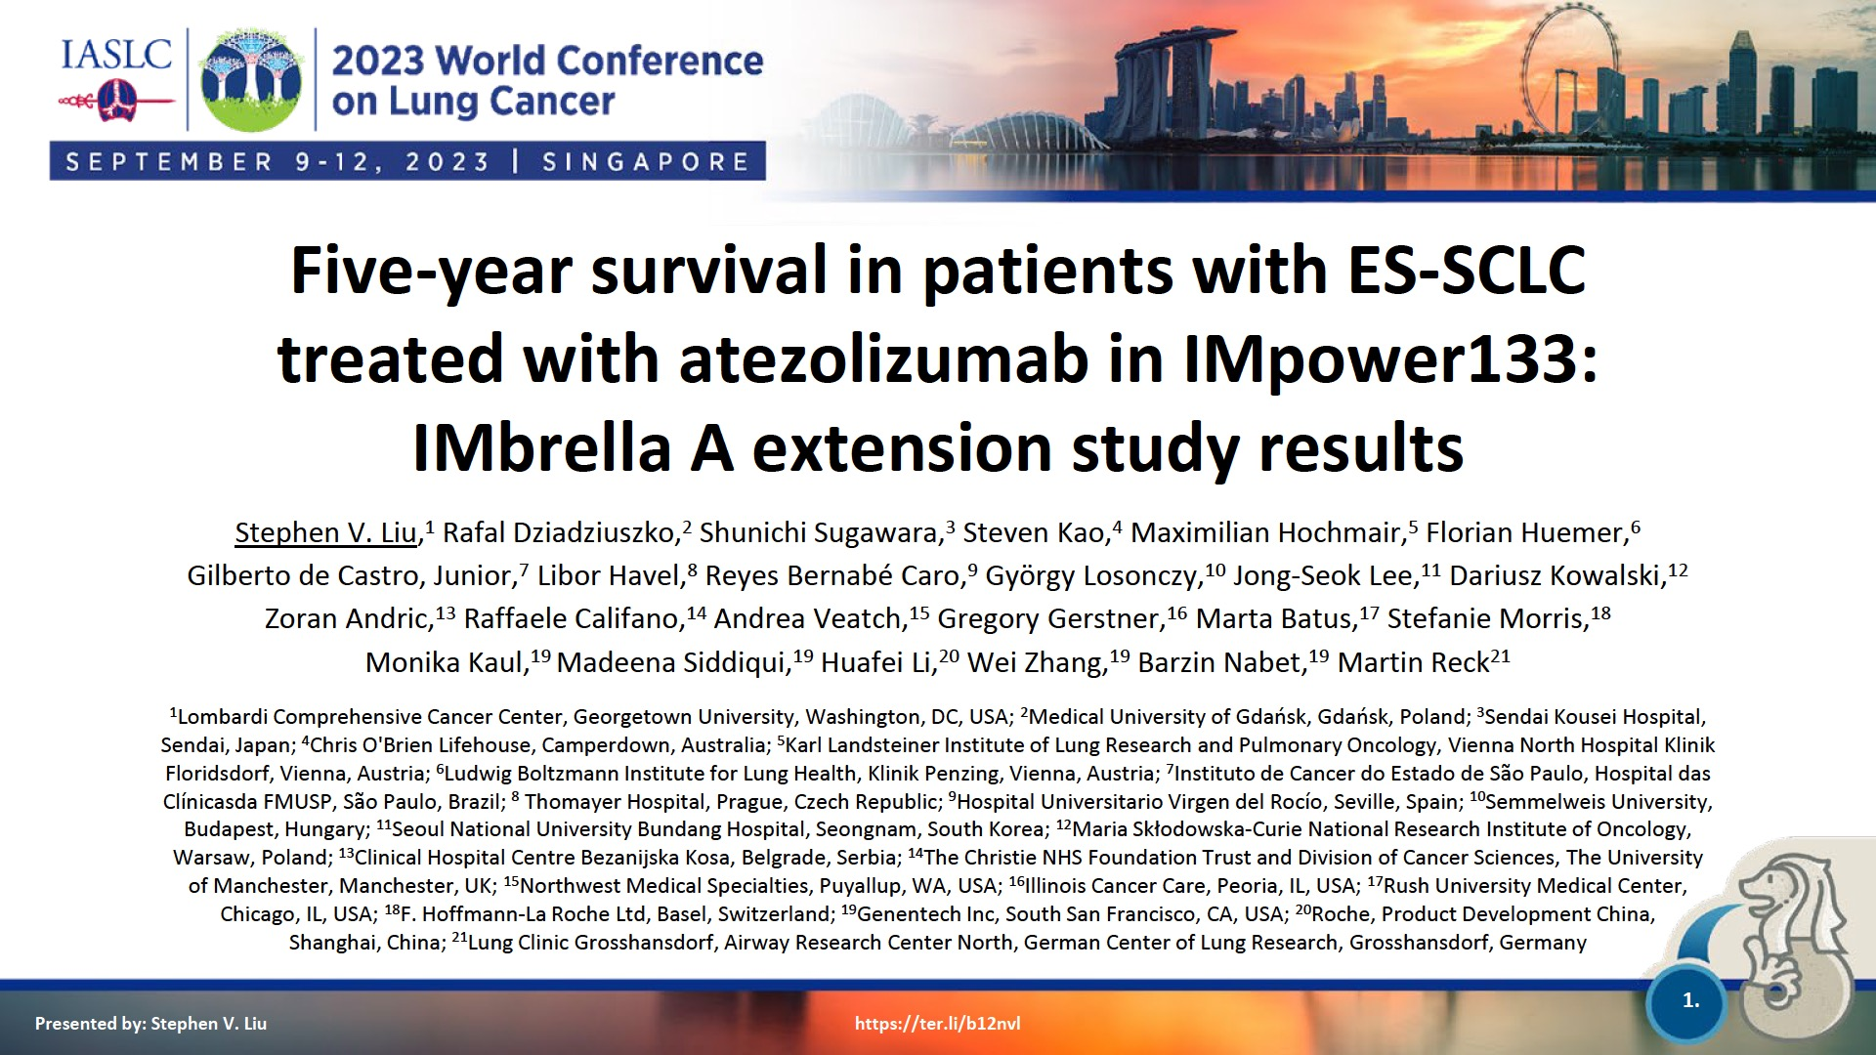
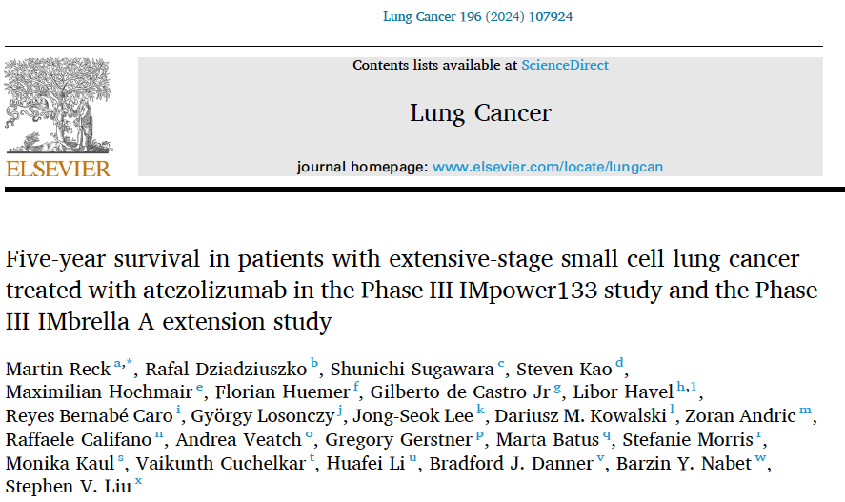

Slide 53
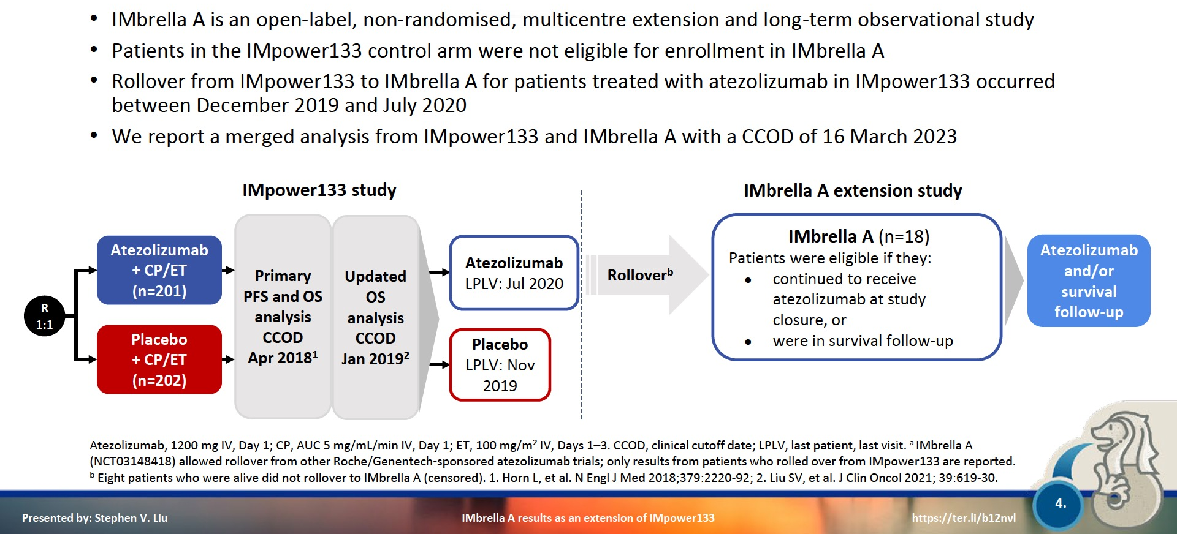
Phase III IMpower133 Study Design (IMbrella A Extension Study)
CP = carboplatin; ET = etoposide; PFS = progression-free survival; OS = overall survival
Liu SV et al. WCLC 2023;Abstract OA01.04

Slide 54
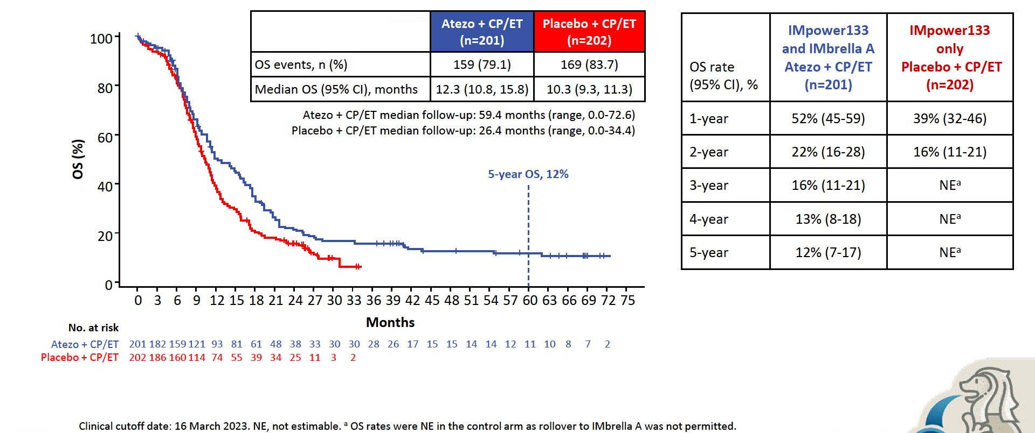
Merged Analysis of IMpower133 and IMbrella A: Long-Term OS
NE = not evaluable
Liu SV et al. WCLC 2023;Abstract OA01.04; Reck M et al. Lung Cancer 2024;196:107924.

Slide 55
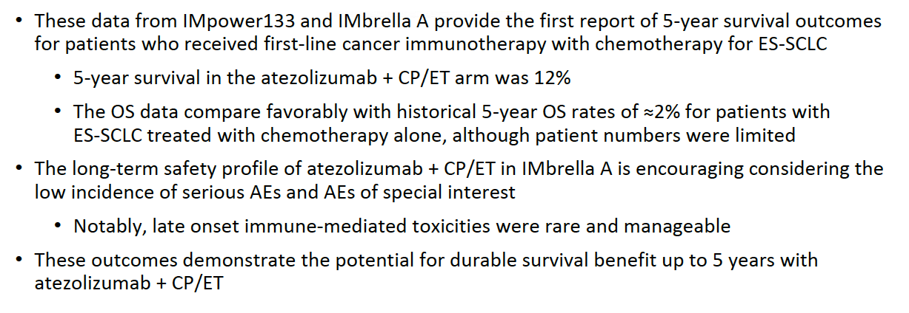
Merged Analysis of IMpower133 and IMbrella A: Authors’ Conclusions
ES-SCLC = extensive-stage small cell lung cancer; AEs = adverse events
Liu SV et al. WCLC 2023;Abstract OA01.04.

Slide 56
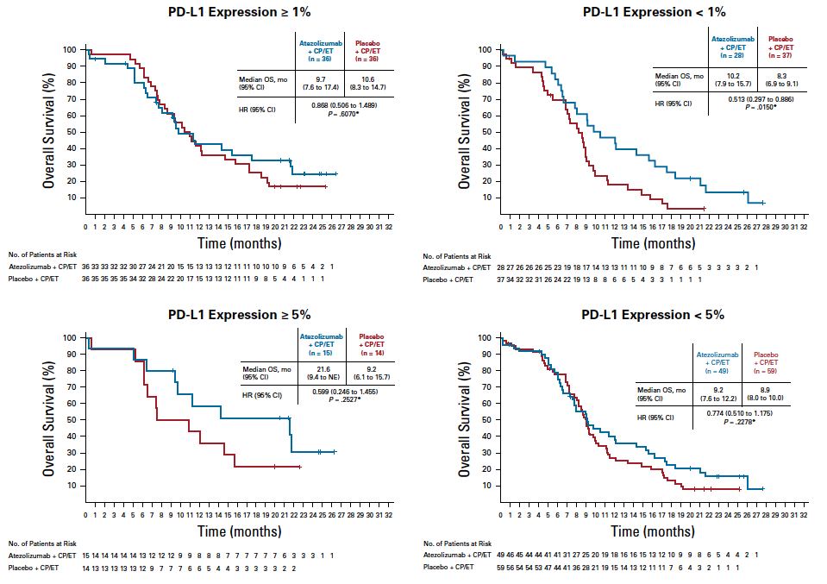
Phase III IMpower133: OS by PD-L1 Expression with Atezolizumab/Carboplatin/Etoposide
Liu SV et al. J Clin Oncol 2021;39:619-30.

Slide 57
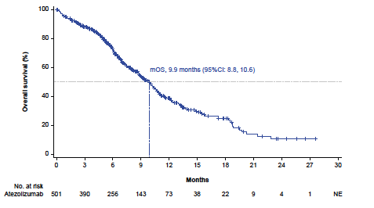
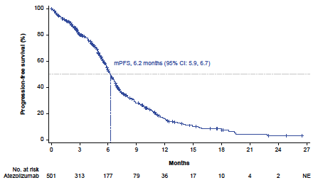
IMreal Study Cohort 4: Efficacy and Safety for Patients with ES-SCLC Receiving First-Line Atezolizumab and Carboplatin/Etoposide Under Real-World Conditions
The safety profile of atezolizumab was consistent with that in the IMpower133 study, and no new or unexpected safety signals were observed.
mOS = median overall survival; mPFS = median progression-free survival
Popat S et al. ESMO 2023;Abstract 1999P.

Slide 58
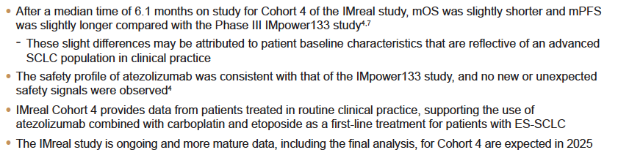
IMreal Cohort 4: Authors’ Conclusions
Popat S et al. ESMO 2023;Abstract 1999P.

Slide 59
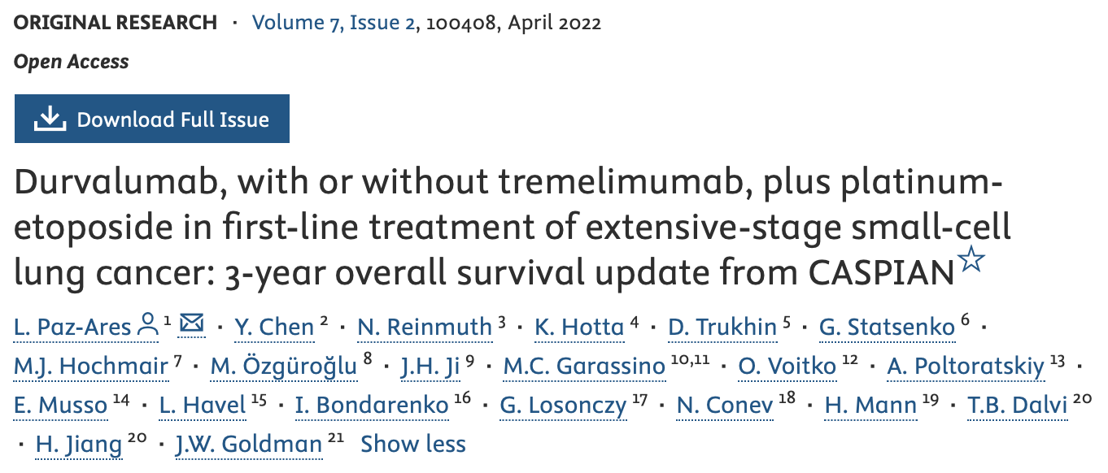
ESMO Open

Slide 60
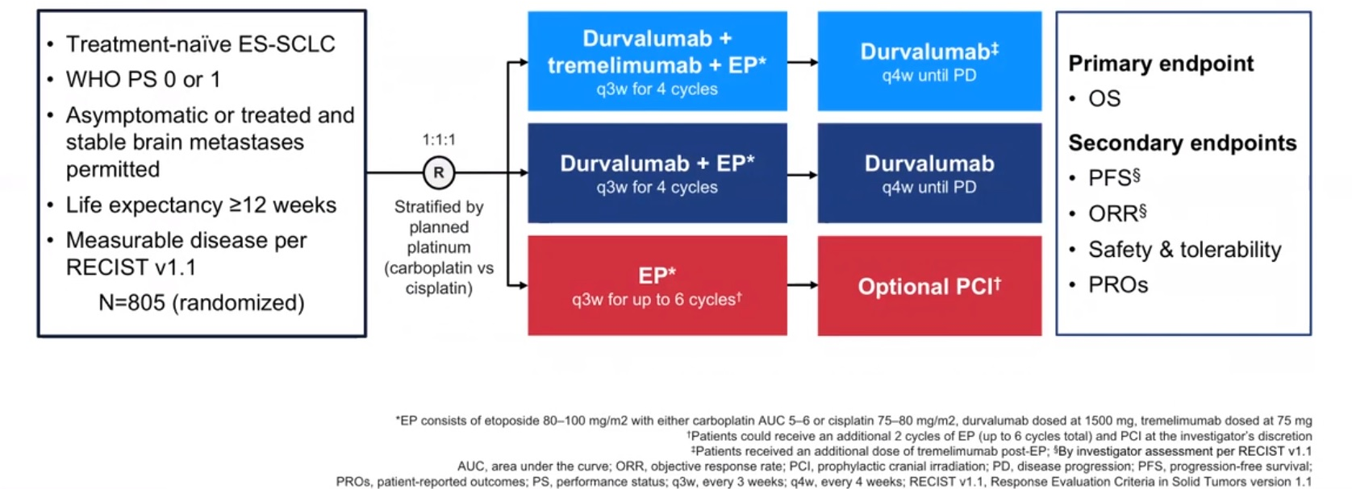
Phase III CASPIAN Study Design
Paz-Ares L et al. ASCO 2020.

Slide 61
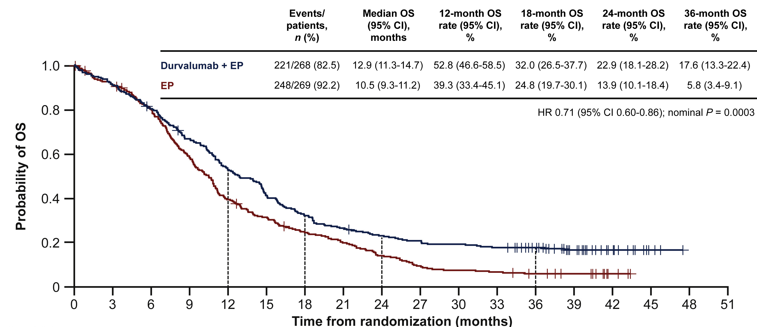
Phase III CASPIAN: OS (ITT Population) Durvalumab/EP versus EP
Paz-Ares L et al. ESMO Open 2022 April;7(2):100408.

Slide 62
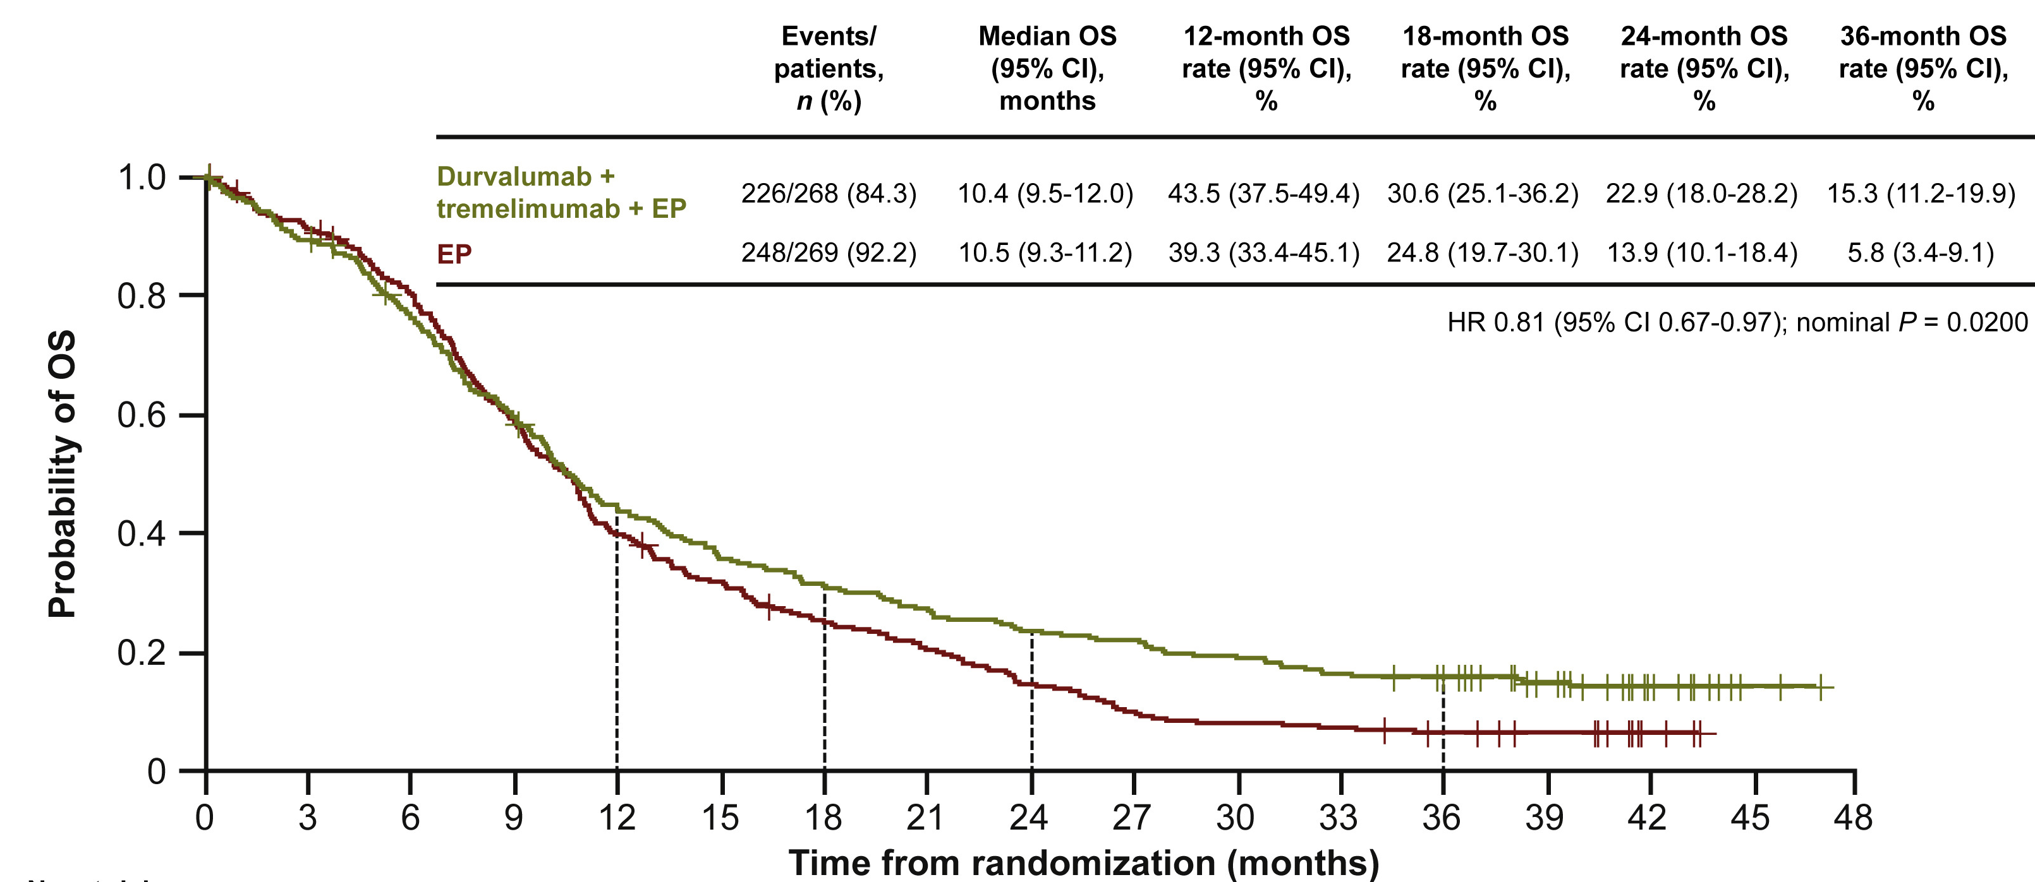
Phase III CASPIAN: OS (ITT Population) Durvalumab/Tremelimumab/EP versus EP
Paz-Ares L et al. ESMO Open 2022 April;7(2):100408.

Slide 63
Phase III CASPIAN: Serious Adverse Events
 | Durvalumab + EP (n = 265) | Durvalumab + tremelimumab + EP (n = 266) | EP (n = 266)
Any serious adverse event, n (%)ª | 86 (32.5) | 126 (47.4) | 97 (36.5)
Febrile neutropenia | 12 (4.5) | 11 (4.1) | 12 (4.5)
Pneumonia | 6 (2.3) | 16 (6.0) | 11 (4.1)
Anemia | 5 (1.9) | 9 (3.4) | 12 (4.5)
Thrombocytopenia | 1 (0.4) | 6 (2.3) | 9 (3.4)
Hyponatremia | 2 (0.8) | 9 (3.4) | 4 (1.5)
Neutropenia | 2 (0.8) | 5 (1.9) | 7 (2.6)
Diarrhea | 2 (0.8) | 7 (2.6) | 4 (1.5)
Pneumonitis | 3 (1.1) | 5 (1.9) | 3 (1.1)
Pancytopenia | 4 (1.5) | 2 (0.8) | 3 (1.1)
Pulmonary embolism | 1 (0.4) | 7 (2.6) | 0
Chronic obstructive pulmonary disease | 3 (1.1) | 2 (0.8) | 1 (0.4)
Death | 0 | 4 (1.5) | 2 (0.8)
Vomiting | 0 | 3 (1.1) | 3 (1.1)
Atrial fibrillation | 2 (0.8) | 3 (1.1) | 0
Colitis | 0 | 5 (1.9) | 0
Dyspnea | 0 | 2 (0.8) | 3 (1.1)
Inappropriate antidiuretic hormone secretion | 0 | 5 (1.9) | 0
Enterocolitis | 0 | 4 (1.5) | 0
Hyperglycemia | 1 (0.4) | 3 (1.1) | 0
Lower respiratory tract infection | 1 (0.4) | 3 (1.1) | 0
Sepsis | 3 (1.1) | 0 | 1 (0.4)
Cerebrovascular accident | 0 | 0 | 3 (1.1)
Hepatitis | 0 | 3 (1.1) | 0
Hypokalemia | 0 | 0 | 3 (1.1)
Septic shock | 3 (1.1) | 0 | 0
Paz-Ares L et al. ESMO Open 2022 April;7(2):100408.

Slide 64
CASPIAN: Authors’ Conclusions
“In conclusion, durvalumab plus EP demonstrated sustained OS benefit over EP with a well-tolerated safety profile after median follow-up of
>3 years, consistent with previous analyses. Three times more patients were estimated to be alive at 3 years when treated with durvalumab
plus EP versus EP alone, with the majority still receiving durvalumab at DCO [data cutoff], further establishing durvalumab plus EP as the standard of care for the first-line treatment of ESSCLC.”
Paz-Ares L et al. ESMO Open 2022 April;7(2):100408.

Slide 65
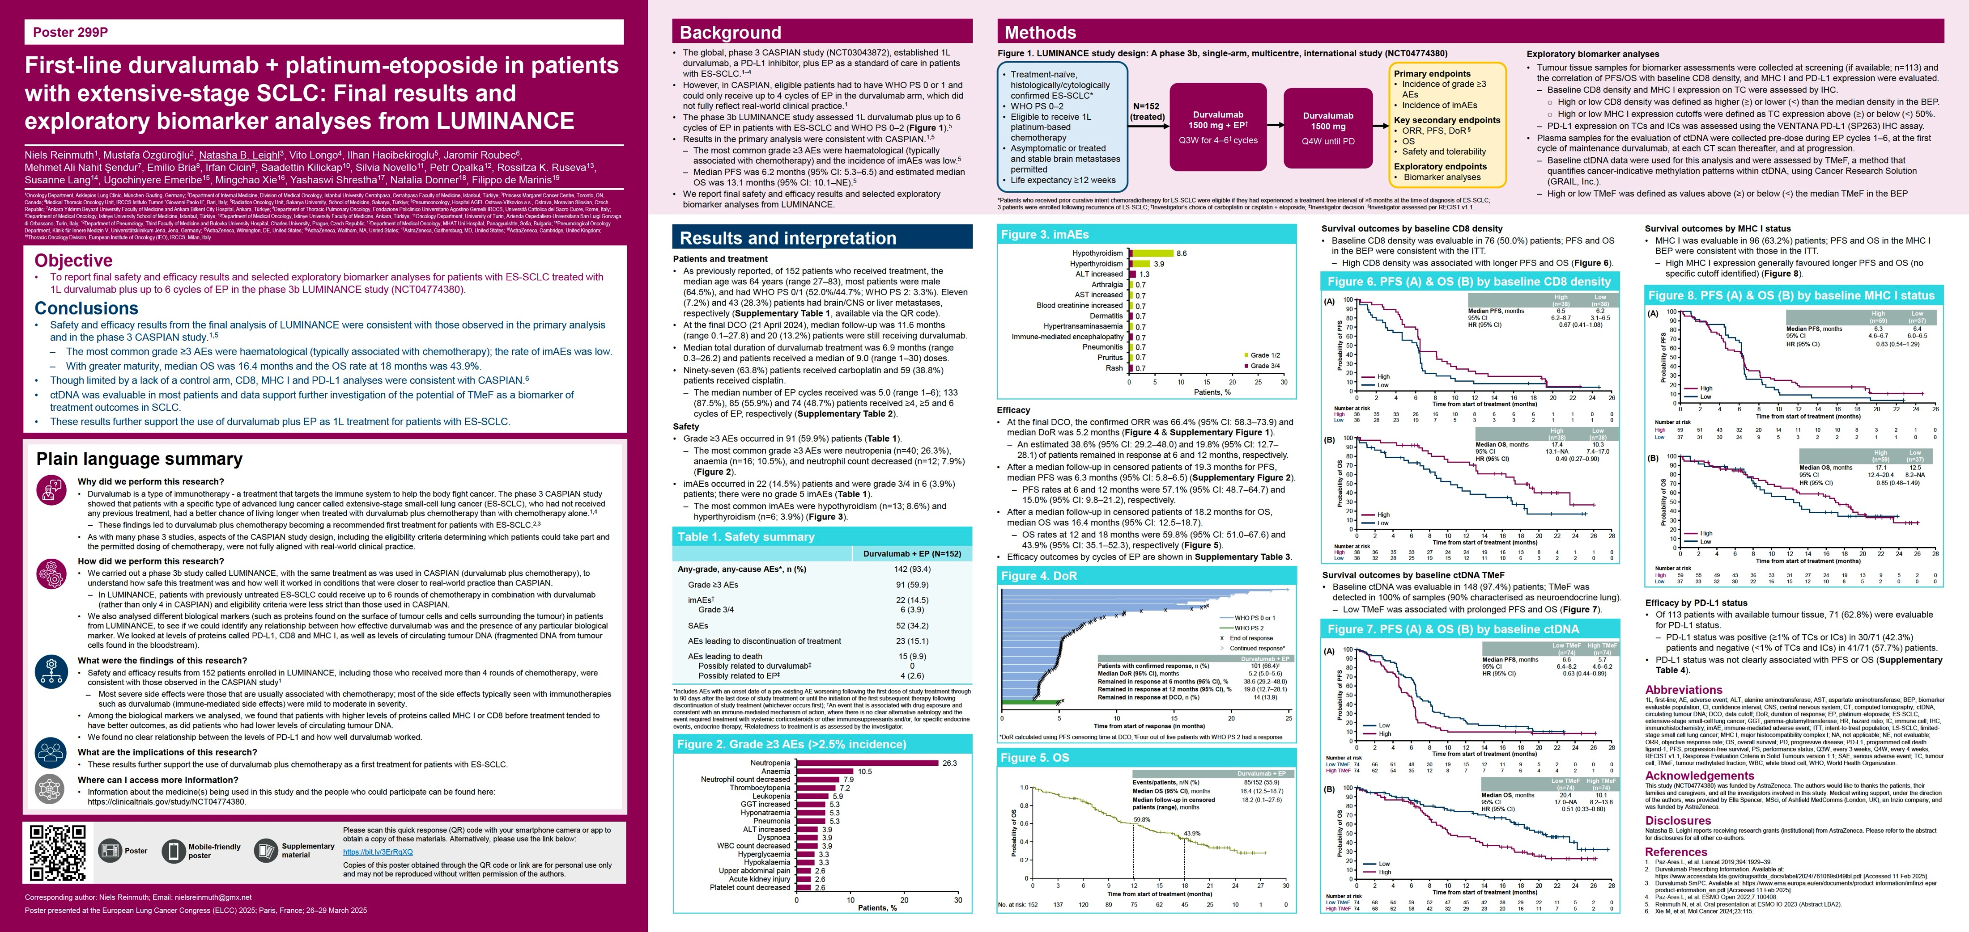
ELCC 2025

Slide 66
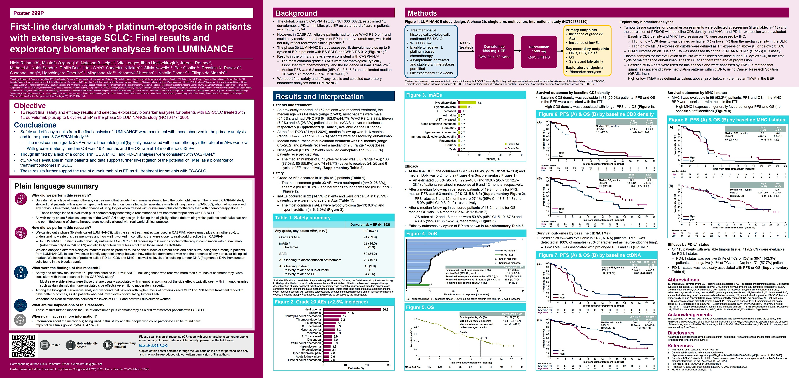
Phase IIIb LUMINANCE Study Design
EP = etoposide/platinum
Reinmuth N et al. ELCC 2025;Abstract 299P.

Slide 67
Phase IIIb LUMINANCE Primary Endpoints: Incidence of AEs and Immune-mediated AEs (imAES)
Reinmuth N et al. ELCC 2025;Abstract 299P.

Slide 68
Phase IIIb LUMINANCE Key Secondary Endpoints: Duration of Response (DoR), OS
Reinmuth N et al. ELCC 2025;Abstract 299P.

Slide 69
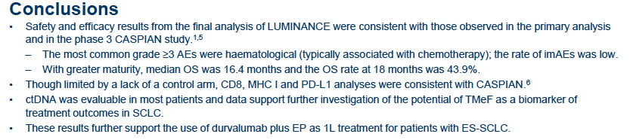
Phase IIIb LUMINANCE: Authors’ Conclusions
ctDNA = circulating tumor DNA; TMeF = tumor methylated fraction
Reinmuth N et al. ELCC 2025;Abstract 299P.

Slide 70
Conclusions and Challenges in SCLC
In limited stage SCLC, Consolidation with Durvalumab for up to 2 yrs is the SOC with ~ 10-12% absolute improvement in long term OS
The addition of CPIs to standard EP chemo in Ext stage SCLC has led to 5 yr OS rates ≥ 10%
Lurbinectedin combined with atezolizumab in the maintenance setting in ES-SCLC has led to statistically significant and clinically meaningful improvements in PFS and OS, albeit heightened toxicity
Tarlatamab is the New SOC in 2L SCLC dramatically displacing lurbinectedin and topotecan based on unprecedented RR%, PFS and OS advantages
Role of ADCs will be determined in the next 12-24 mos
We lack clear biomarkers and reproducible targets

Slide 71
Up-Front Treatment of Extensive-Stage Small Cell Lung Cancer
Module 1: First-Line Chemoimmunotherapy
General Questions
Patients with Tumor-Related Complications
Patients with Comorbidities
Management of Transformed Non-Small Cell Lung Cancer; Prostate Cancer

Slide 72
General Questions
Atezo vs durva — any efficacy or safety differences?
Cisplatin vs carboplatin — does it matter?
What to offer if platinum ineligible?
Tumor lysis syndrome?
Trilaciclib for myeloprotection?
Consolidative thoracic RT?
Role of ipilimumab/nivolumab?

Slide 73
General Questions
IO rechallenge after autoimmune complications (pneumonitis, diabetes, adrenal insufficiency, cardiomyopathy, arthritis)
Patient on chemo-IO: diarrhea differential — chemo, infection, or ICI colitis?
Do immune toxicities correlate with higher response rates?
Do prior IO toxicities predict CRS/ICANS with tarlatamab?
IO in transplant recipient

Slide 74
General Questions
Prophylactic cranial irradiation (PCI) vs MRI surveillance
Surgery for solitary brain met — any role in SCLC?
Consolidative thoracic RT during maintenance IO ± lurbinectedin?
Management of transformed NSCLC (prostate cancer)?

Slide 75
General Questions
Oligometastatic disease — when to use systemic vs local therapy?
Patient with LS-SCLC developed brain metastases 2 mo after chemoRT (no systemic disease) — other options besides radiation?
After definitive CRT + IO (ADRIATIC strategy) — what to do at progression?

Slide 76
General Questions
Role of MRD testing for early progression detection and 2L initiation
Benefits of smoking cessation — outcome impact
Intrabronchial tumor debulking — data and indications

Slide 77
Patients with Tumor-Related Complications
Patient with hyponatremia and seizures at diagnosis, good initial response for 2 years, then recurrence with pancreatic lesion (SCLC) and recurrent SIADH → improved after 2 cycles of lurbinectedin.
SIADH with persistent low sodium — management challenges
Refractory SIADH management (salt tablets, fluid restriction?)
Contraindications to IO in autoimmune paraneoplastic syndromes
Does neurologic paraneoplastic disease resolve with treatment?

Slide 78
Patients with Tumor-Related Complications
SCLC with SVC syndrome: whether to start systemic therapy or radiation first
Stage dependency: limited vs extensive SCLC in SVC management
Venous access issues in SVC setting
Community challenges: inpatient RT often unavailable → start inpatient chemo + plan outpatient RT
IVC stenting — any role or parallels to SVC?
Role of prophylactic or consolidative RT after resolution of SVC

Slide 79
Patients with Comorbidities
80-year-old female with COPD (EF 30%), CKD (eGFR 30 mL/min), ischemic cardiomyopathy, diabetes and ES-SCLC → what is the most appropriate front-line approach?
Young female heavy smoker with COPD on frequent steroids for exacerbations — would you include IO in stage IV SCLC?
Steroid use (eg, COPD exacerbations) — does it compromise IO efficacy?
62-year-old female ex-smoker with S-SCLC and myasthenia gravis — would you consider IO in this autoimmune paraneoplastic setting?
IOs in patients with autoimmune disease

Slide 80
Up-Front Treatment of Extensive-Stage Small Cell Lung Cancer
Introduction: Tail on the Curve?
Module 1: First-Line Chemoimmunotherapy
Module 2: Maintenance Lurbinectedin
Data Review: IMforte Trial
Clinical Discussion

Slide 81
FDA Approves Lurbinectedin in Combination with Atezolizumab or Atezolizumab and Hyaluronidase-Tqjs for ES-SCLC Press Release: October 2, 2025
“On October 2, 2025, the Food and Drug Administration approved lurbinectedin in combination with atezolizumab or atezolizumab and hyaluronidase-tqjs for the maintenance treatment of adult patients with extensive-stage small cell lung cancer (ES-SCLC) whose disease has not progressed after first-line induction therapy with atezolizumab or atezolizumab and hyaluronidase-tqjs, carboplatin, and etoposide.
Efficacy was evaluated in IMforte (NCT05091567), a randomized, multicenter, open-label trial in patients receiving first-line treatment for ES-SCLC. In IMforte, 483 patients with ES-SCLC whose disease had not progressed after completion of four cycles of atezolizumab, carboplatin, and etoposide (induction treatment) were randomized (1:1) to receive either lurbinectedin in combination with atezolizumab administered intravenously (IV) or atezolizumab IV alone until disease progression or unacceptable toxicity.”
https://www.fda.gov/drugs/resources-information-approved-drugs/fda-approves-lurbinectedin-combination-atezolizumab-or-atezolizumab-and-hyaluronidase-tqjs-extensive

Slide 82
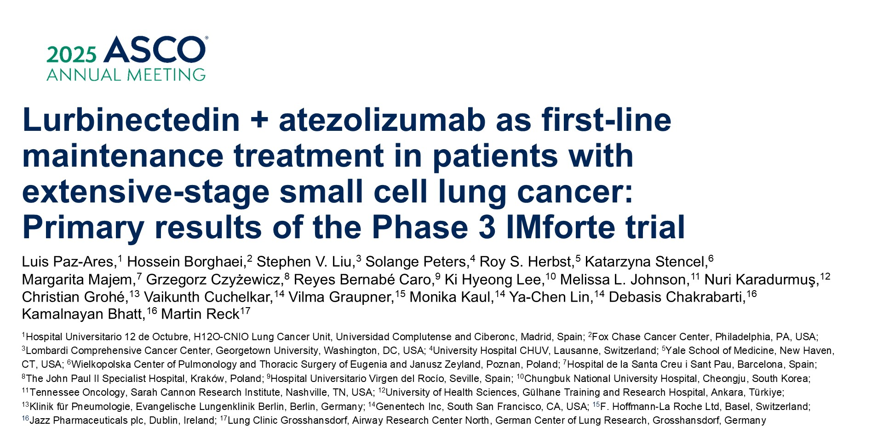
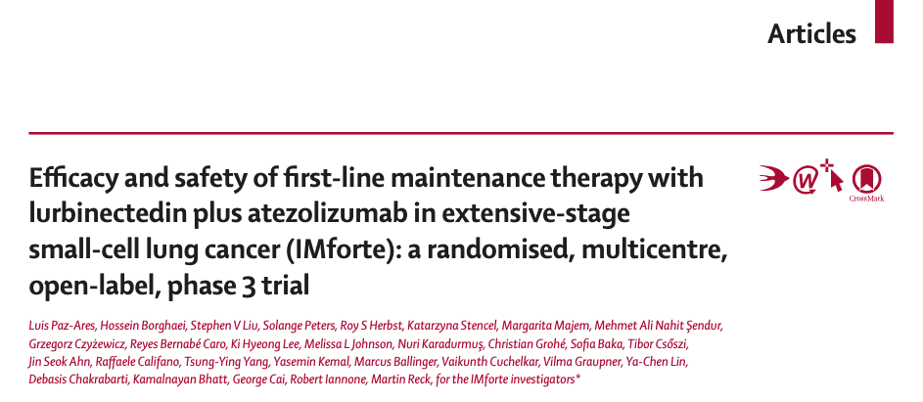
Abstract 8006
Lancet 2025;405(10495):2129-43

Slide 83
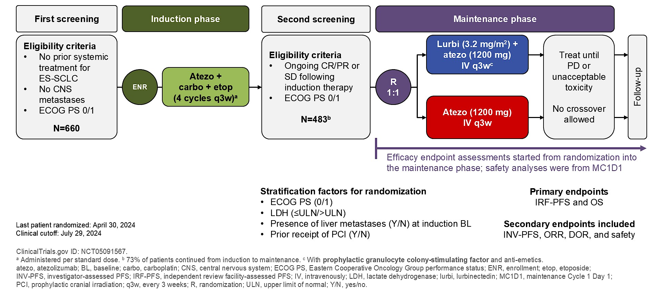
Phase III IMforte Study Design
CR =complete response; PR = partial response; SD = stable disease
Paz-Ares L et al. ASCO 2025;Abstract 8006.

Slide 84
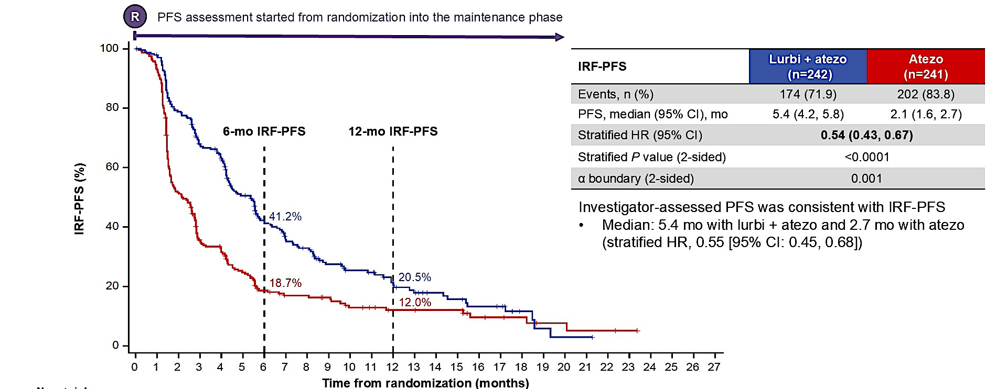
Phase III IMforte: Independent Review Facility-Assessed PFS (IRF-PFS)
Paz-Ares L et al. ASCO 2025;Abstract 8006. Paz-Ares L et al. Lancet 2025;405(10495):2129-43.

Slide 85
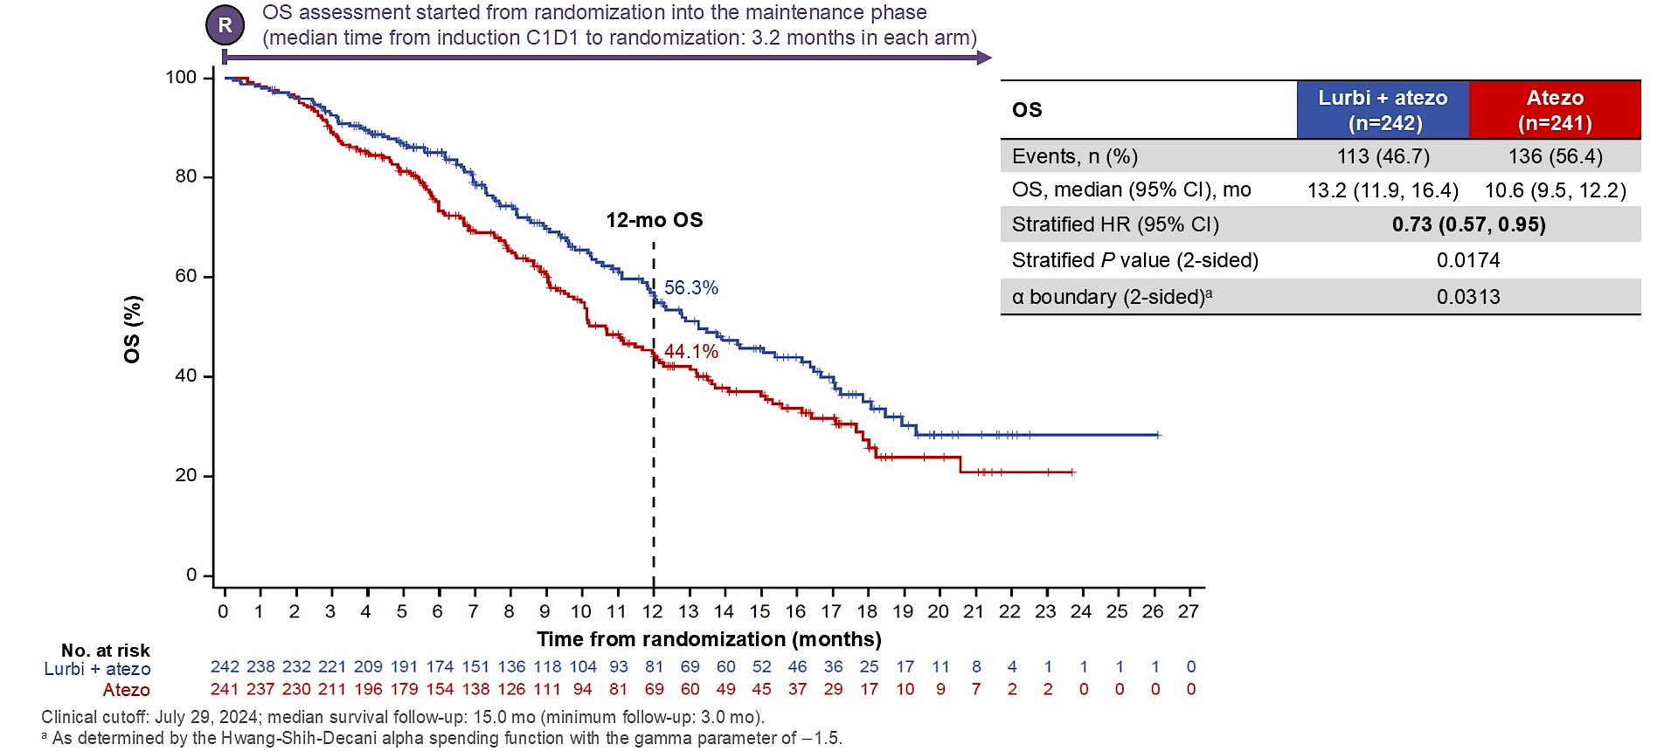
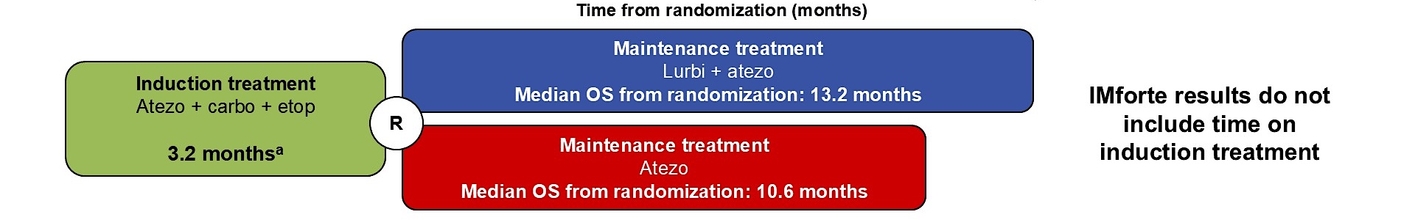
IMforte: Overall Survival (OS) from Randomization into Maintenance Phase
Paz-Ares L et al. ASCO 2025;Abstract 8006. Paz-Ares L et al. Lancet 2025;405(10495):2129-43.

Slide 86
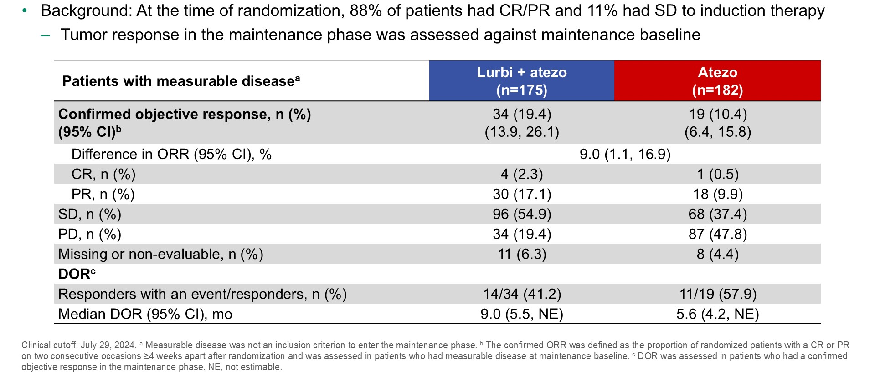
Phase III IMforte: Confirmed IRF-Assessed Objective Response Rate (ORR), DoR
Paz-Ares L et al. ASCO 2025;Abstract 8006. Paz-Ares L et al. Lancet 2025;405(10495):2129-43.

Slide 87
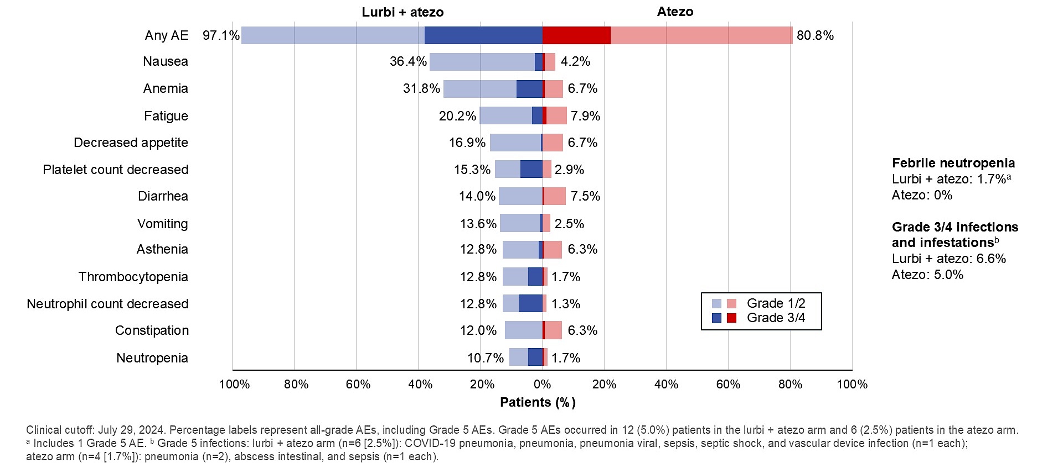
IMforte: All-Cause Adverse Events (AEs) with Incidence ≥10% in Either Arm
Paz-Ares L et al. ASCO 2025;Abstract 8006. Paz-Ares L et al. Lancet 2025;405(10495):2129-43.

Slide 88
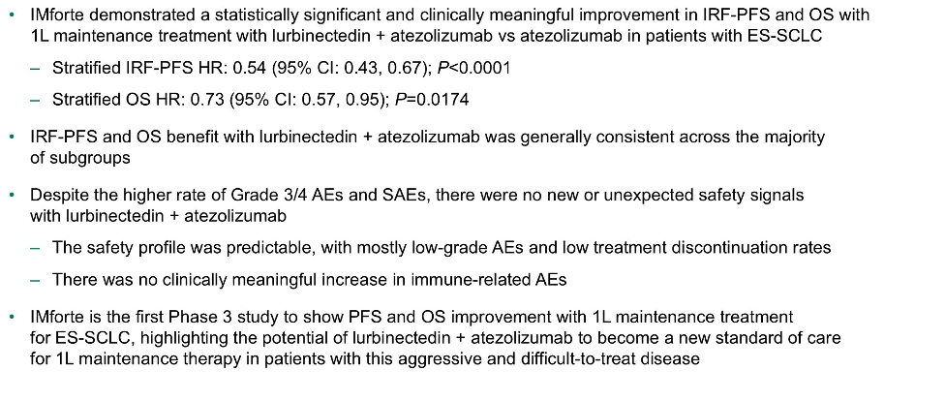
IMforte: Authors’ Conclusions
Paz-Ares L et al. ASCO 2025;Abstract 8006. Paz-Ares L et al. Lancet 2025;405(10495):2129-43.

Slide 89
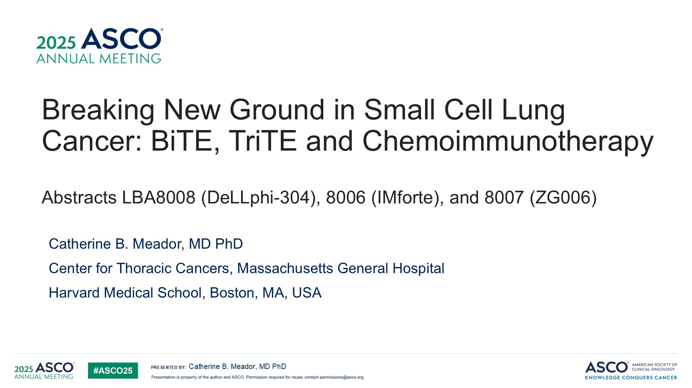
Meador CB et al. ASCO 2025;Discussant.

Slide 90
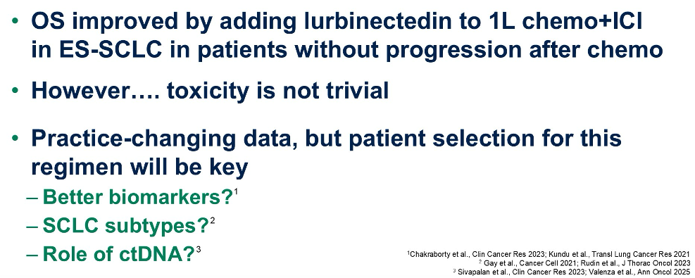
IMforte: Conclusions and Practice Implications
ICI = immune checkpoint inhibitor
Meador CB et al. ASCO 2025;Discussant.

Slide 91
Maintenance Lurbinectedin
Is maintenance lurbinectedin now standard?
How do clinicians adjust dosing/frequency for toxicity?
Who are optimal candidates (fit vs comorbid, platinum sensitive vs refractory)?
Are there subsets (good PS, younger, low burden) most likely to benefit?
How long should therapy continue — indefinite or capped?
When to stop one of the agents (lurbinectedin vs IO)?

Slide 92
Maintenance Lurbinectedin
Can this be used with durvalumab instead of atezo?
Would you switch durva-treated patients to atezo + lurbi?
What are the expected toxicities (hematologic, fatigue, neuropathy, hepatic)?
Rates of myelotoxicity, neutropenia, fatigue, discontinuation

Slide 93
Up-Front Treatment of Extensive-Stage Small Cell Lung Cancer
Introduction: Tail on the Curve?
Module 1: First-Line Chemoimmunotherapy
Module 2: Maintenance Lurbinectedin
Module 3: Second-Line Treatment, Tarlatamab
Data Review: DeLLphi-304 Trial
Clinical Discussion

Slide 94
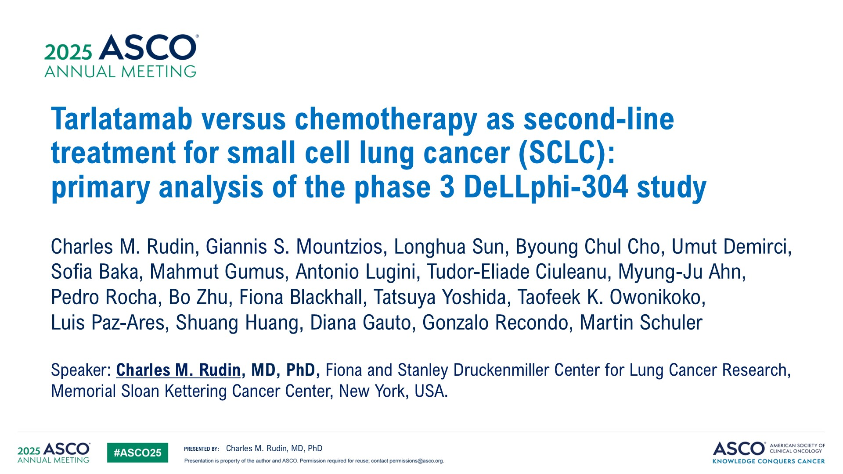
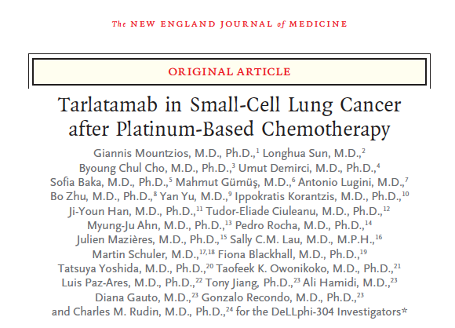
Abstract LBA8008

Slide 95
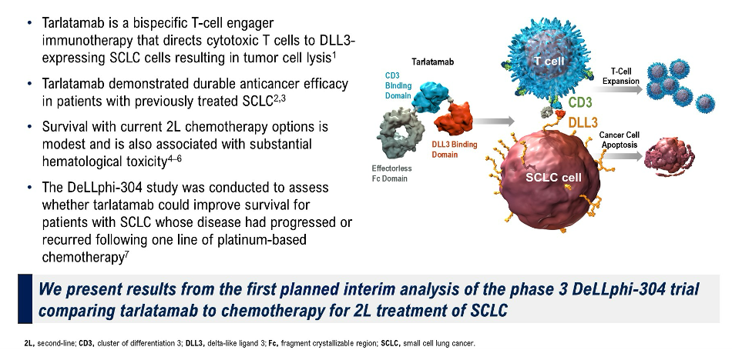
DeLLphi-304 Background
Rudin CM et al. ASCO 2025;Abstract LBA8008.

Slide 96
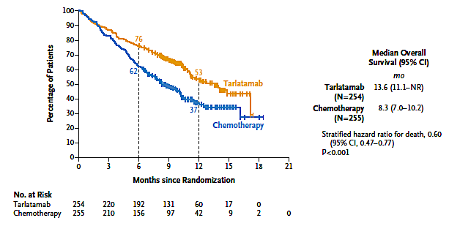
DeLLphi-304 Primary Endpoint: Overall Survival
Rudin CM et al. ASCO 2025;Abstract LBA8008; Mountzios G et al. N Engl J Med June 2 2025;[Online ahead of print].

Slide 97
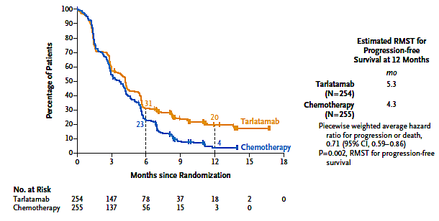
DeLLphi-304: Progression-Free Survival
RMST = restricted mean survival time
Rudin CM et al. ASCO 2025;Abstract LBA8008; Mountzios G et al. N Engl J Med June 2 2025;[Online ahead of print].

Slide 98
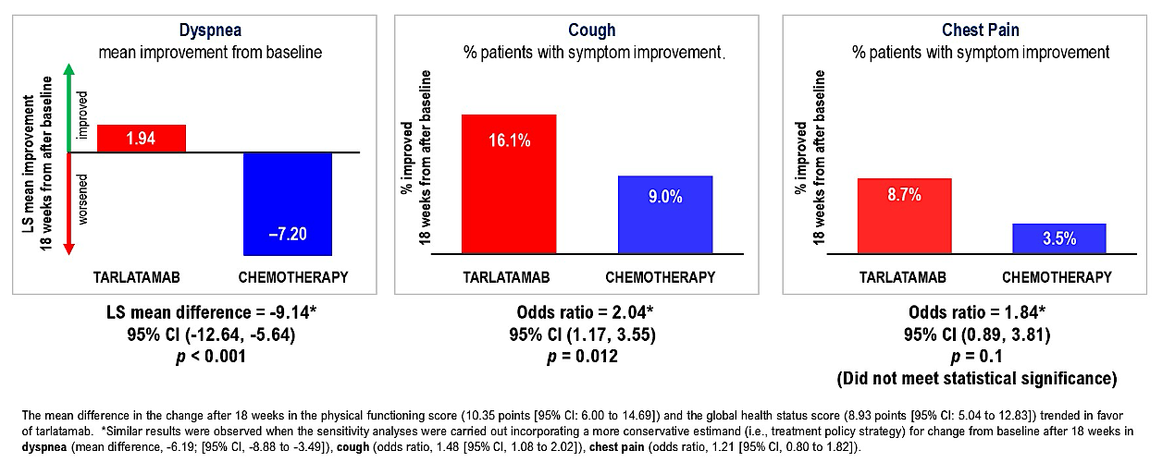
DeLLphi-304: Symptom Change from Baseline
LS = least squares
Rudin CM et al. ASCO 2025;Abstract LBA8008.

Slide 99
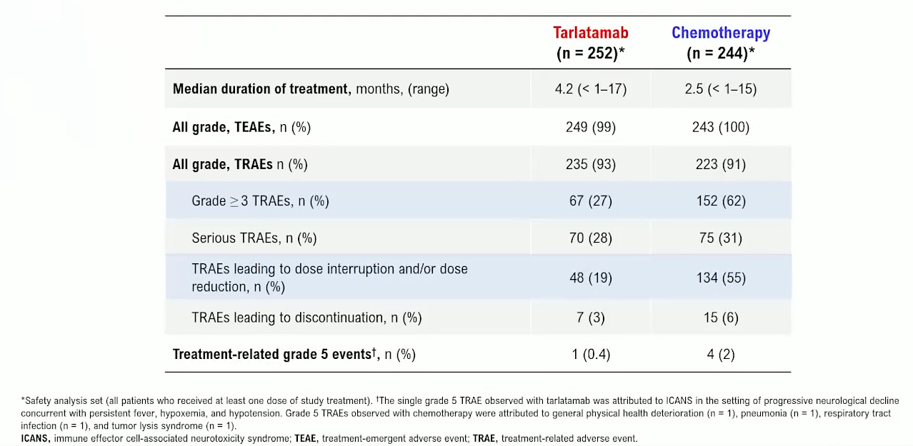
DeLLphi-304: Tarlatamab Safety Profile
Rudin CM et al. ASCO 2025;Abstract LBA8008.

Slide 100
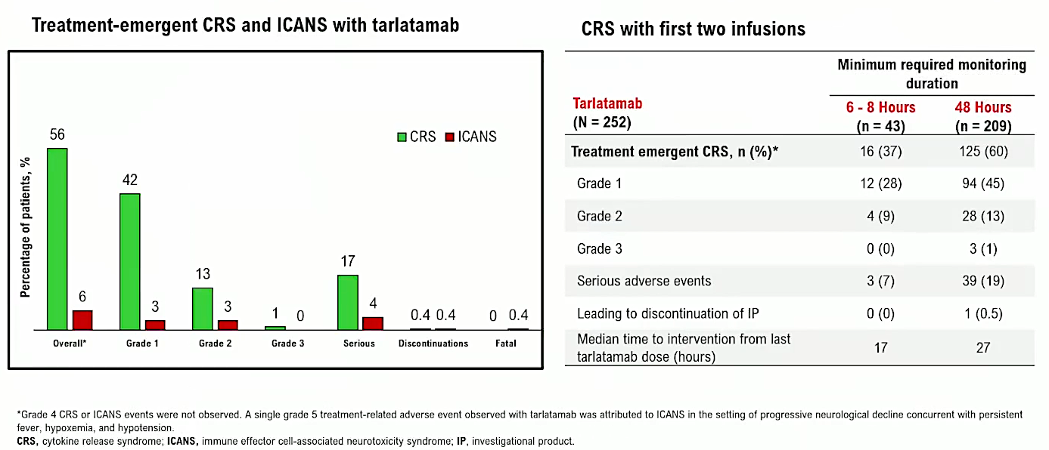
DeLLphi-304: CRS and ICANS Events
Rudin CM et al. ASCO 2025;Abstract LBA8008.

Slide 101

DeLLphi-304: Authors’ Conclusions
Rudin CM et al. ASCO 2025;Abstract LBA8008.

Slide 102

Evolving Management Strategies for Cytokine Release Syndrome (CRS)
Meador CB et al. ASCO 2025;Discussant.

Slide 103

ES-SCLC: Current Treatment Landscape
Meador CB et al. ASCO 2025;Discussant.

Slide 104
Second-Line Treatment: Tarlatamab
Sequencing of lurbinectedin and tarlatamab
71-year-old man with ES-SCLC: PR to carbo/etoposide/atezolizumab — maintenance atezo/ lurbinectedin; progressed at 6 months? Platinum rechallenge vs tarlatamab?
Is platinum sensitivity still relevant in the tarlatamab era?
Use in inpatient vs outpatient setting — safety data, monitoring

Slide 105
Second-Line Treatment: Tarlatamab
How to administer tarlatamab safely without inpatient induction
CRS management and learning curve for staff
Step-up dosing protocols — can these be outpatient?
Trials for community accessibility (to avoid mandatory hospitalization)
Challenges and toxicity profiles — managing side effects
Use as 1L or maintenance — ongoing trials or rationale

Slide 106
Up-Front Treatment of Extensive-Stage Small Cell Lung Cancer
Introduction: Tail on the Curve?
Module 1: First-Line Chemoimmunotherapy
Module 2: Maintenance Lurbinectedin
Module 3: Second-Line Treatment, Tarlatamab
Module 4: Ongoing Research

Slide 107

Abstract 2757O

Slide 108

Phase Ib DeLLphi-303 Study Design
Wermke M et al. ESMO 2025;Abstract 2757O.

Slide 109

Phase Ib DeLLphi-303 Primary Endpoint: Safety Summary
Wermke M et al. ESMO 2025;Abstract 2757O.

Slide 110

Phase Ib DeLLphi-303: Timing of TRAEs (Primary Endpoint)
Wermke M et al. ESMO 2025;Abstract 2757O.

Slide 111

Phase Ib DeLLphi-303: Treatment-Emergent CRS, ICANS
Wermke M et al. ESMO 2025;Abstract 2757O.

Slide 112

Phase Ib DeLLphi-303: Responses
Wermke M et al. ESMO 2025;Abstract 2757O.

Slide 113

Phase Ib DeLLphi-303: Overall Survival
Wermke M et al. ESMO 2025;Abstract 2757O.

Slide 114

Phase Ib DeLLphi-303: Progression-Free Survival
Wermke M et al. ESMO 2025;Abstract 2757O.

Slide 115

Phase Ib DeLLphi-303: Authors’ Conclusions
Wermke M et al. ESMO 2025;Abstract 2757O.

Slide 116

The Road Ahead: Tarlatamab
LS-SCLC = limited-stage small cell lung cancer
Meador CB et al. ASCO 2025;Discussant.

Slide 117
Phase III DeLLphi-305 Trial: Tarlatamab with Durvalumab as First-Line Maintenance in ES-SCLC
Trial Identifier: NCT06211036
Tarlatamab (Q2W)
+
Durvalumab (Q4W)
(N ~ 275)
OS
Primary endpoint:
OS
Key secondary endpoint:
PFS
Other secondary endpoints:
PFS
OS
ORR
DCR
DoR
R 1:1
TTP
PRO/QoL
Number of participants with TEAEs
Serum concentrations of tarlatamab
Incidence of anti-tarlatamab antibody formation
N ~ 550
Durvalumab (Q4W)
(N ~ 275)
Key inclusion criteria: Patients aged ≥18 years with ECOG PS of 0 to 1 and histologically or cytologically confirmed ES-SCLC who completed 3-4 cycles of platinum-etoposide chemotherapy with concurrent durvalumab without progression
Key exclusion criteria: Symptomatic CNS metastases or leptomeningeal disease; active systemic infections; active HIV and/or hepatitis B/C; prior therapy targeting DLL3
Perol M et al. WCLC 2024;Abstract P1.13A.02; www.clinicaltrials.gov. NCT06211036 Accessed November 2025.

Slide 118

Phase II IDeate-Lung01 Study Design
I-DXd = ifinatamab deruxtecan
Hayashi H et al. JSMO 2025;Abstract O12-4.

Slide 119

Ifinatamab Deruxtecan (I-DXd)
Hayashi H et al. Japanese Society of Medical Oncology (JSMO) 2025;Abstract O12-4.

Slide 120

IDeate-Lung01: Responses
Hayashi H et al. JSMO 2025;Abstract O12-4.

Slide 121

IDeate-Lung01: Survival
Hayashi H et al. JSMO 2025;Abstract O12-4.

Slide 122

IDeate-Lung01: Intracranial Activity of I-DXd
Hayashi H et al. JSMO 2025;Abstract O12-4.

Slide 123

IDeate-Lung01: Authors’ Conclusions
Hayashi H et al. JSMO 2025;Abstract O12-4.

Slide 124

IDeate-Lung01: Adverse Events
Hayashi H et al. JSMO 2025;Abstract O12-4.

Slide 125

Phase III IDeate-Lung02 Study
Primary endpoints: ORR, OS
Secondary endpoints: ORR, PFS, DOR, DCR, TTR, PROs, Safety, Immunogenicity, Pharmacokinetics, Relationship between B7-H3 expression and outcomes
Hayashi H et al. JSMO 2025;Abstract P93-5.

Slide 126

Phase Ib/II IDeate-Lung03 Study
Primary endpoints: Safety (DLTs [Part A] and TEAEs [Parts A and B])
Secondary endpoints: PFS, ORR, DCR, DOR, CBR, TTR, Best percentage change in sum of diameters of measurable tumors, OS, Pharmacokinetics, Immunogenicity
Hayashi H et al. JSMO 2025;Abstract P93-6.

Slide 127
Ongoing Research
When will ifinatamab deruxtecan be FDA approved? CNS activity?
Sequencing of lurbinectedin, tarlatamab and ifinatamab deruxtecan

Slide 128
Cancer Q&A: Understanding the Role and Reality of CAR (Chimeric Antigen Receptor) T-Cell Therapy for Non-Hodgkin Lymphoma
A CME/MOC-Accredited Webinar Developed in Partnership with CancerCare®
Wednesday, November 12, 2025 5:00 PM – 6:00 PM ET
Faculty
Jeremy S Abramson, MD, MMSc
Loretta J Nastoupil, MD
Moderator
Neil Love, MD

Slide 129
Thank you for joining us! Please take a moment to complete the survey currently up on Zoom. Your feedback is very important to us. The survey will remain open for 5 minutes after the meeting ends. Information on how to obtain CME, ABIM MOC and ABS credit is provided in the Zoom chat room. Attendees will also receive an email in 1 to 3 business days with these instructions.

