Slide 1
Cancer Q&A: Understanding the Role and Reality of CAR (Chimeric Antigen Receptor) T-Cell Therapy for Non-Hodgkin Lymphoma
A CME/MOC-Accredited Webinar Developed in Partnership with CancerCare®
Wednesday, November 12, 2025 5:00 PM – 6:00 PM ET
Faculty
Jeremy S Abramson, MD, MMSc
Loretta J Nastoupil, MD
Moderator
Neil Love, MD

Slide 2
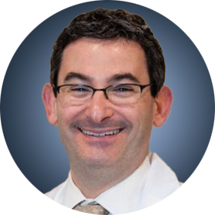
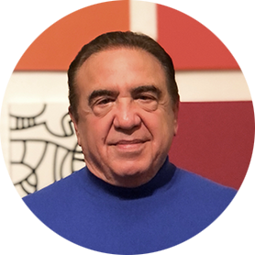
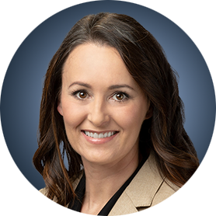
Faculty
Jeremy S Abramson, MD, MMSc
Director, Center for Lymphoma
Massachusetts General Hospital
Professor of Medicine
Harvard Medical School
Boston, Massachusetts
MODERATOR
Neil Love, MD Research To Practice Miami, Florida
Loretta J Nastoupil, MD
Oncologist
Southwest Oncology
CommonSpirit Mercy Hospital
Durango, Colorado

Slide 3
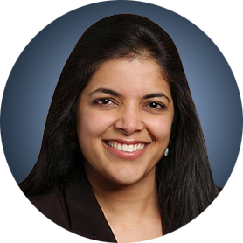
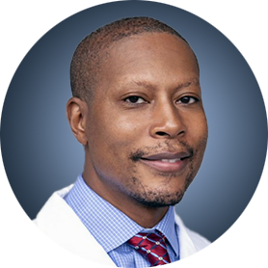
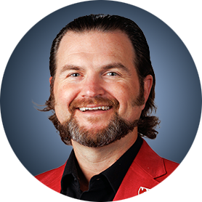
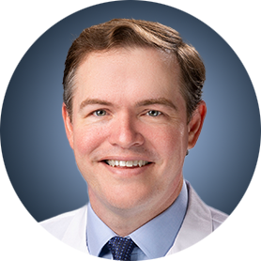
Survey Participants
Manali Kamdar, MD, MBBS
Associate Professor
Clinical Director of Lymphoma Services
Morton and Sandra Saffer Endowed Chair in Hematology Research
Division of Hematology, Hematologic Malignancies
University of Colorado Cancer Center
Aurora, Colorado
Tycel Phillips, MD, FASCO
Associate Professor, Division of Lymphoma
Department of Hematology and Hematopoietic Cell Transplantation
City of Hope Comprehensive Cancer Center
Duarte, California
Matthew Lunning, DO
Professor
Medical Director, Gene and Cellular Therapy
Associate Vice Chair of Research, Department of Medicine
Assistant Vice Chancellor for Clinical Research
Fred and Pamela Buffett Cancer Center
University of Nebraska Medical Center
Omaha, Nebraska
Jason Westin, MD, MS
Director, Lymphoma Clinical Research
Section Chief, Aggressive Lymphoma
Professor, Department of Lymphoma and Myeloma
The University of Texas MD Anderson Cancer Center
Houston, Texas

Slide 4
Commercial Support
This activity is supported by educational grants from Bristol Myers Squibb and Novartis.

Slide 5
Dr Love — Disclosures
Dr Love is president and CEO of Research To Practice. Research To Practice receives funds in the form of educational grants to develop CME activities from the following companies: Aadi Bioscience, AbbVie Inc, ADC Therapeutics, Agendia Inc, Alexion Pharmaceuticals, Amgen Inc, Array BioPharma Inc, a subsidiary of Pfizer Inc, Arvinas, Astellas, AstraZeneca Pharmaceuticals LP, Aveo Pharmaceuticals, Bayer HealthCare Pharmaceuticals, BeOne, Black Diamond Therapeutics Inc, Blueprint Medicines, Boehringer Ingelheim Pharmaceuticals Inc, Bristol Myers Squibb, Celcuity, Clovis Oncology, Coherus BioSciences, Corcept Therapeutics Inc, CTI BioPharma, a Sobi Company, Daiichi Sankyo Inc, Eisai Inc, Elevation Oncology Inc, Exact Sciences Corporation, Exelixis Inc, Genentech, a member of the Roche Group, Genmab US Inc, Geron Corporation, Gilead Sciences Inc, GSK, Helsinn Therapeutics (US) Inc, Hologic Inc, ImmunoGen Inc, Incyte Corporation, Ipsen Biopharmaceuticals Inc, Jazz Pharmaceuticals Inc, Johnson & Johnson, Karyopharm Therapeutics, Kite, A Gilead Company, Kura Oncology, Legend Biotech, Lilly, MEI Pharma Inc, Merck, Mersana Therapeutics Inc, Mirati Therapeutics Inc, Mural Oncology Inc, Natera Inc, Novartis, Novartis Pharmaceuticals Corporation on behalf of Advanced Accelerator Applications, Novocure Inc, Nuvalent, Pfizer Inc, Pharmacyclics LLC, an AbbVie Company, Puma Biotechnology Inc, Regeneron Pharmaceuticals Inc, Rigel Pharmaceuticals Inc, R-Pharm US, Sanofi, Seagen Inc, Servier Pharmaceuticals LLC, SpringWorks Therapeutics Inc, Stemline Therapeutics Inc, Sumitomo Pharma America, Syndax Pharmaceuticals, Taiho Oncology Inc, Takeda Pharmaceuticals USA Inc, TerSera Therapeutics LLC, and Tesaro, A GSK Company.

Slide 6
Research To Practice CME Planning Committee Members, Staff and Reviewers
Planners, scientific staff and independent reviewers for Research To Practice have no relevant conflicts of interest to disclose.

Slide 7
Dr Abramson — Disclosures Faculty
Consulting Agreements | AbbVie Inc, ADC Therapeutics, AstraZeneca Pharmaceuticals LP, BeOne, Bristol Myers Squibb, Celgene Corporation, Foresight Diagnostics, Genentech, a member of the Roche Group, Gilead Sciences Inc, Interius BioTherapeutics, Miltenyi Biotec, Novartis, Roche Laboratories Inc, Seagen Inc
Contracted Research | Bristol Myers Squibb, Celgene Corporation, Cellectis, Genentech, a member of the Roche Group, Merck, Mustang Bio, Regeneron Pharmaceuticals Inc, Seagen Inc, Takeda Pharmaceuticals USA Inc

Slide 8
Dr Nastoupil — Disclosures Faculty
Advisory Committees | AbbVie Inc, AstraZeneca Pharmaceuticals LP, Bristol Myers Squibb, Daiichi Sankyo Inc, Genentech, a member of the Roche Group, Genmab US Inc, Ipsen Biopharmaceuticals Inc, Janssen Biotech Inc, Kite, A Gilead Company, Merck, Novartis, Regeneron Pharmaceuticals Inc, Takeda Pharmaceuticals USA Inc
Consulting Agreements | Genentech, a member of the Roche Group
Contracted Research | BeOne, Bristol Myers Squibb, Daiichi Sankyo Inc, Genentech, a member of the Roche Group, Janssen Biotech Inc, Kite, A Gilead Company, Merck, Novartis, Takeda Pharmaceuticals USA Inc
Data and Safety Monitoring Boards/Committees | Genentech, a member of the Roche Group

Slide 9
Dr Kamdar — Disclosures Survey Participant
Consulting Agreements | AbbVie Inc, AstraZeneca Pharmaceuticals LP, BeOne, Bristol Myers Squibb, Genentech, a member of the Roche Group
Data and Safety Monitoring Boards/Committees | Bristol Myers Squibb, Genentech, a member of the Roche Group

Slide 10
Dr Lunning — Disclosures Survey Participant
Consulting/Honoraria | AbbVie Inc, Acrotech Biopharma, ADC Therapeutics, AstraZeneca Pharmaceuticals LP, Bristol Myers Squibb, Caribou Biosciences Inc, Fate Therapeutics, Genentech, a member of the Roche Group, Genmab US Inc, Incyte Corporation, Ipsen Biopharmaceuticals Inc, Janssen Biotech Inc, Kite, A Gilead Company, Loxo Oncology Inc, a wholly owned subsidiary of Eli Lilly & Company, Nurix Therapeutics Inc, Pfizer Inc, Recordati, Regeneron Pharmaceuticals Inc, Seagen Inc, Veeva, Vittoria Biotherapeutics
Research Funding | AbbVie Inc, Bristol Myers Squibb, Fate Therapeutics, Kite, A Gilead Company

Slide 11
Dr Phillips — Disclosures Survey Participant
Advisory Committees | AbbVie Inc, Genentech, a member of the Roche Group, Genmab US Inc, Merck
Consulting Agreements | AbbVie Inc, ADC Therapeutics, AstraZeneca Pharmaceuticals LP, BeOne, Bristol Myers Squibb, Caribou Biosciences Inc, Genentech, a member of the Roche Group, Genmab US Inc, Gilead Sciences Inc, Ipsen Biopharmaceuticals Inc, Janssen Biotech Inc, Kite, A Gilead Company, Lilly, Merck, Pfizer Inc, Regeneron Pharmaceuticals Inc, Xencor
Contracted Research | AbbVie Inc, Genentech, a member of the Roche Group, Sobi
Nonrelevant Financial Relationships | Blood Cancer United Scholar in Clinical Research

Slide 12
Dr Westin — Disclosures Survey Participant
Advisory Committees | Genentech, a member of the Roche Group, Kite, A Gilead Company, Novartis
Consulting Agreements | AbbVie Inc, ADC Therapeutics, Allogene Therapeutics, AstraZeneca Pharmaceuticals LP, Bristol Myers Squibb, Genentech, a member of the Roche Group, Genmab US Inc, Incyte Corporation, Janssen Biotech Inc, Kite, A Gilead Company, MorphoSys, Novartis, Nurix Therapeutics Inc, Pfizer Inc, Regeneron Pharmaceuticals Inc
Contracted Research | ADC Therapeutics, Allogene Therapeutics, AstraZeneca Pharmaceuticals LP, Bristol Myers Squibb, Genentech, a member of the Roche Group, Incyte Corporation, Janssen Biotech Inc, Kite, A Gilead Company, MorphoSys, Novartis, Nurix Therapeutics Inc, Regeneron Pharmaceuticals Inc

Slide 13
This educational activity contains discussion of non-FDA-approved uses of agents and regimens. Please refer to official prescribing information for each product for approved indications.

Slide 14
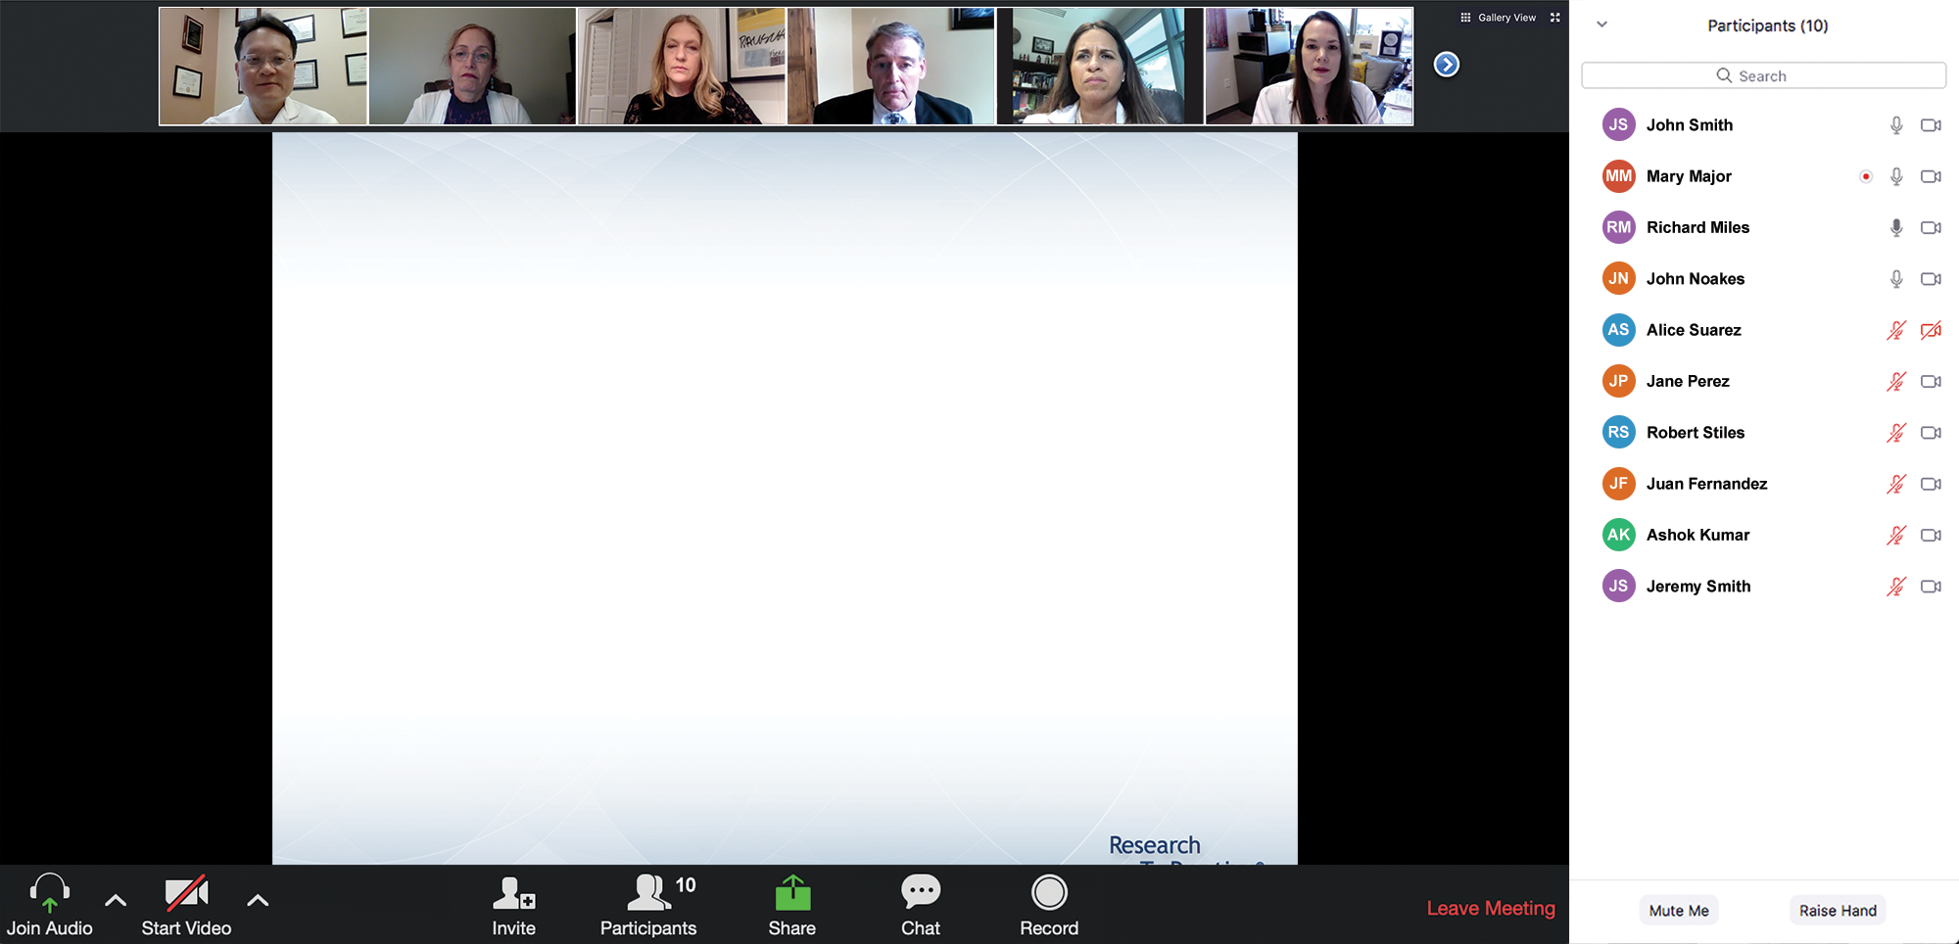
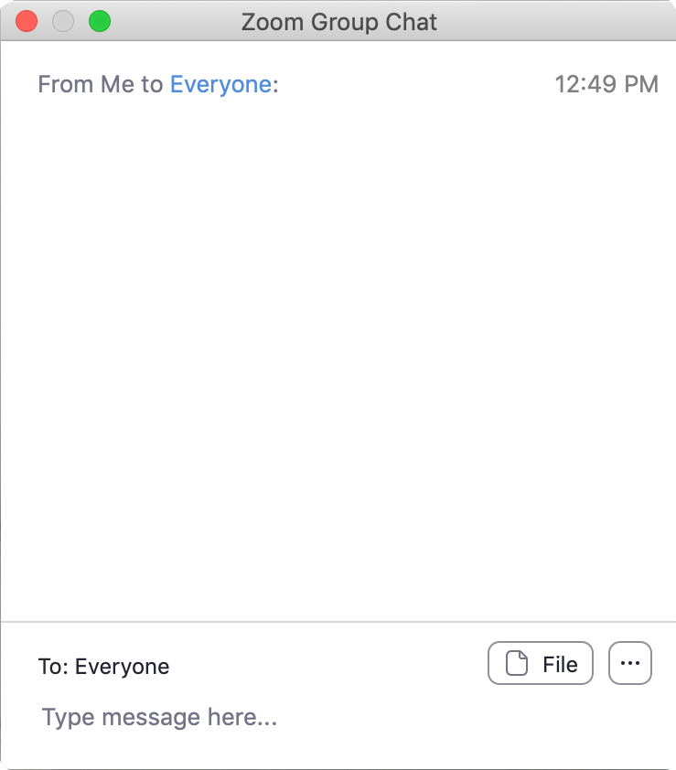
We Encourage Clinicians in Practice to Submit Questions
Feel free to submit questions now before the program begins and throughout the program.

Slide 15
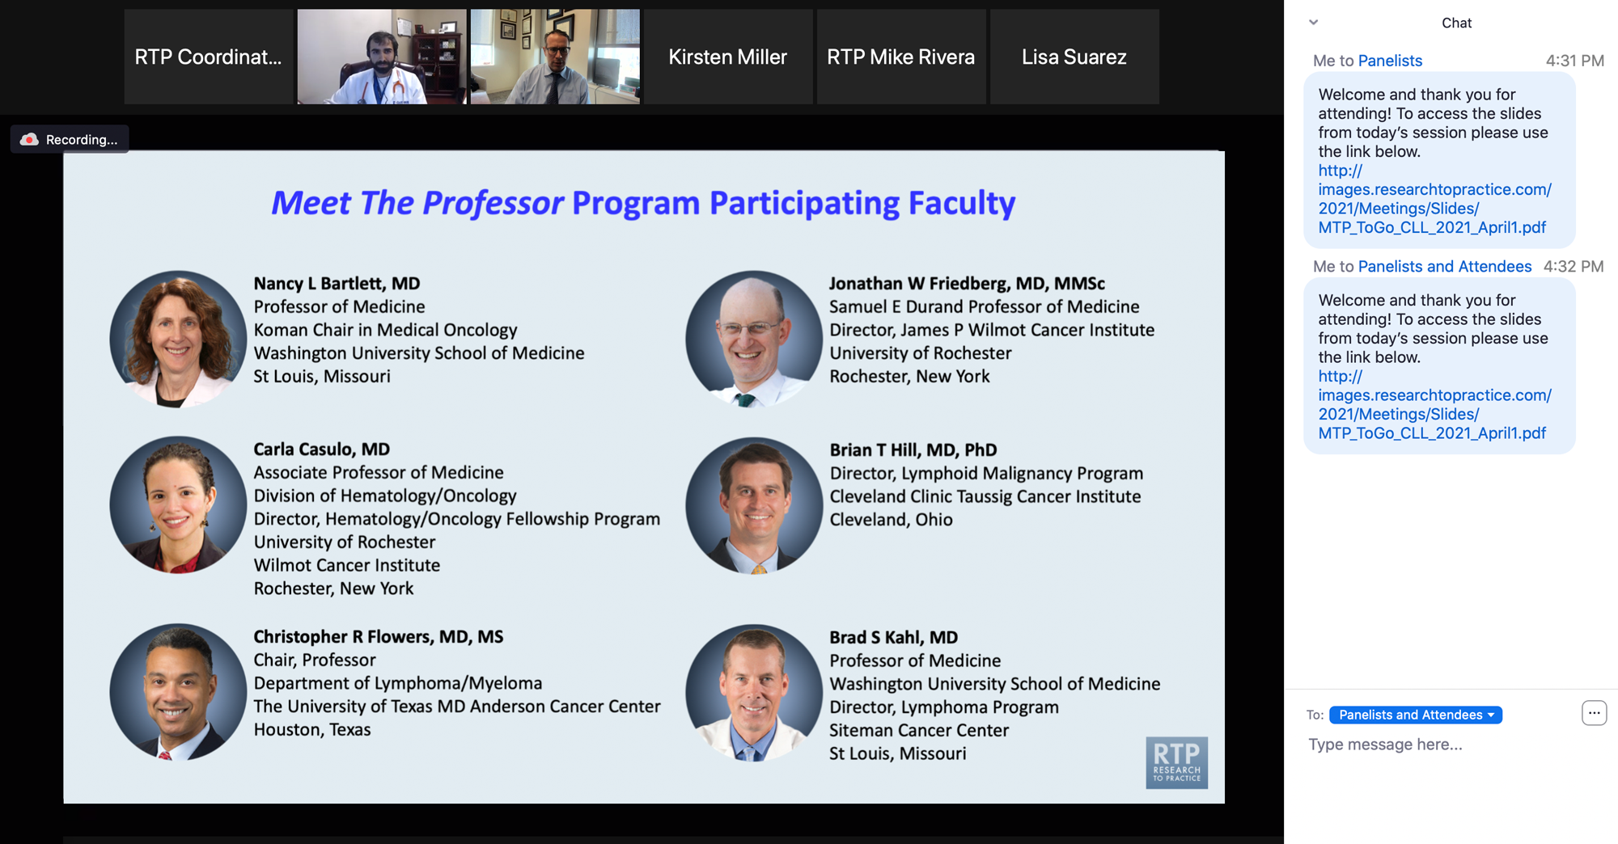
Familiarizing Yourself with the Zoom Interface
Expand chat submission box
Drag the white line above the submission box up to create more space for your message.

Slide 16
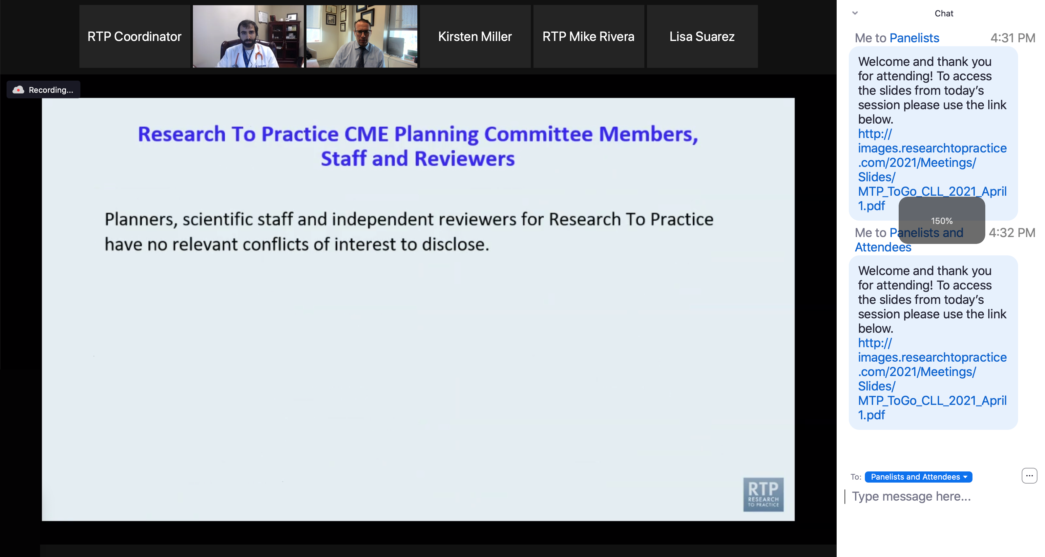
Familiarizing Yourself with the Zoom Interface
Increase chat font size
Press Command (for Mac) or Control (for PC) and the + symbol. You may do this as many times as you need for readability.

Slide 17
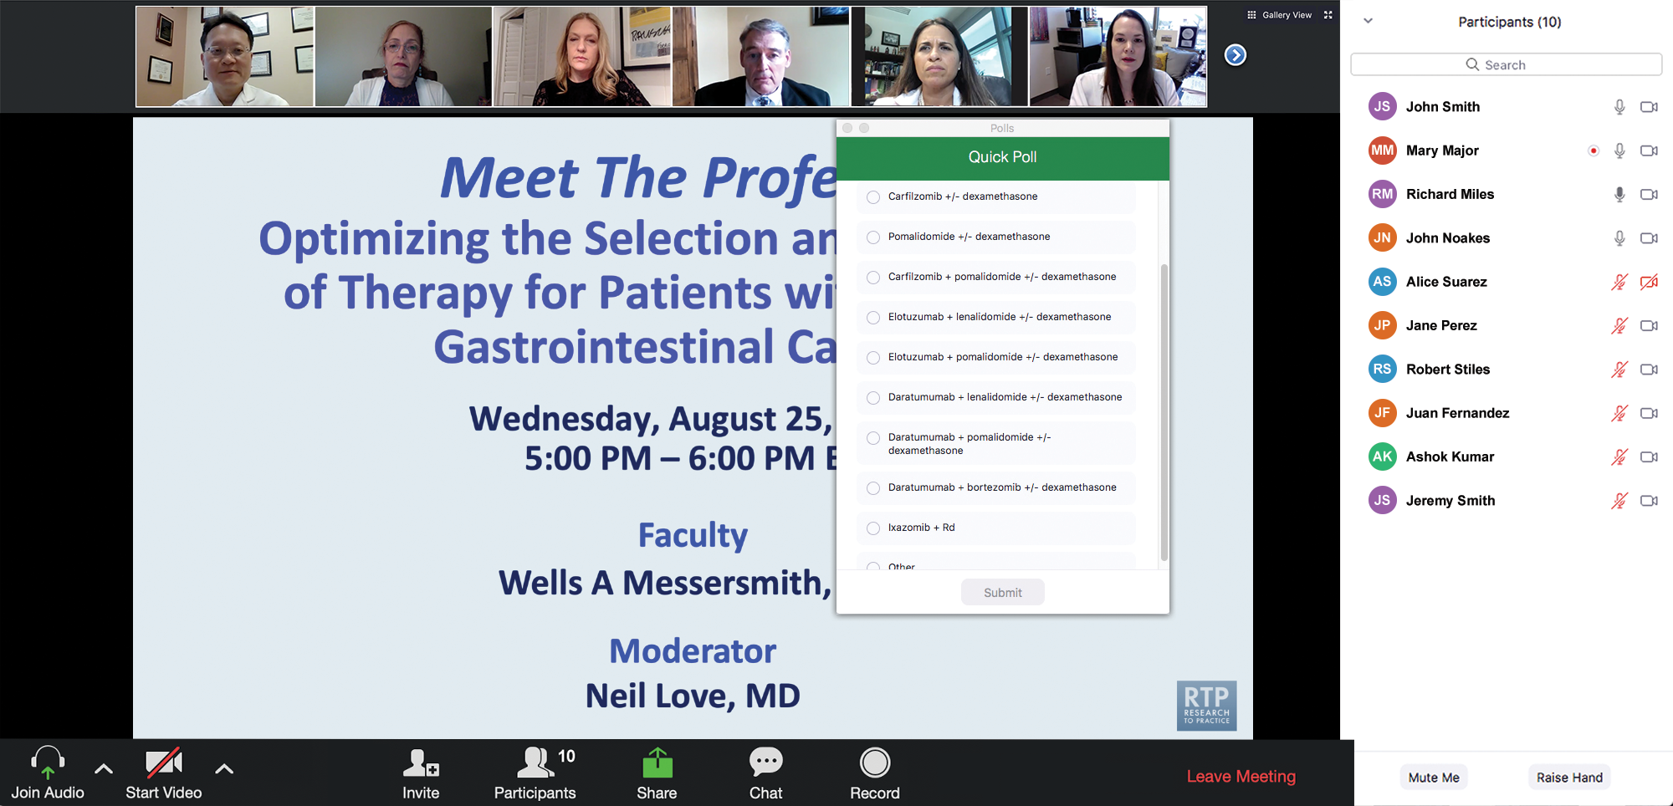
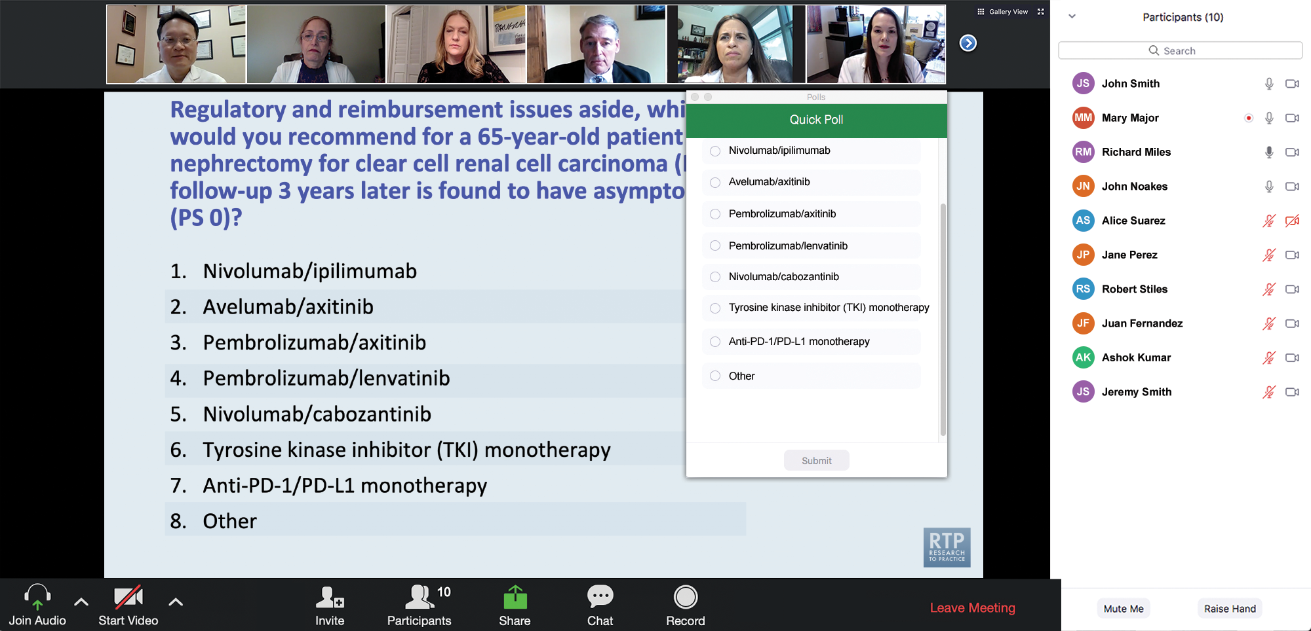
Clinicians in the Audience, Please Complete the Pre- and Postmeeting Surveys
Quick Survey
Quick Poll

Slide 18
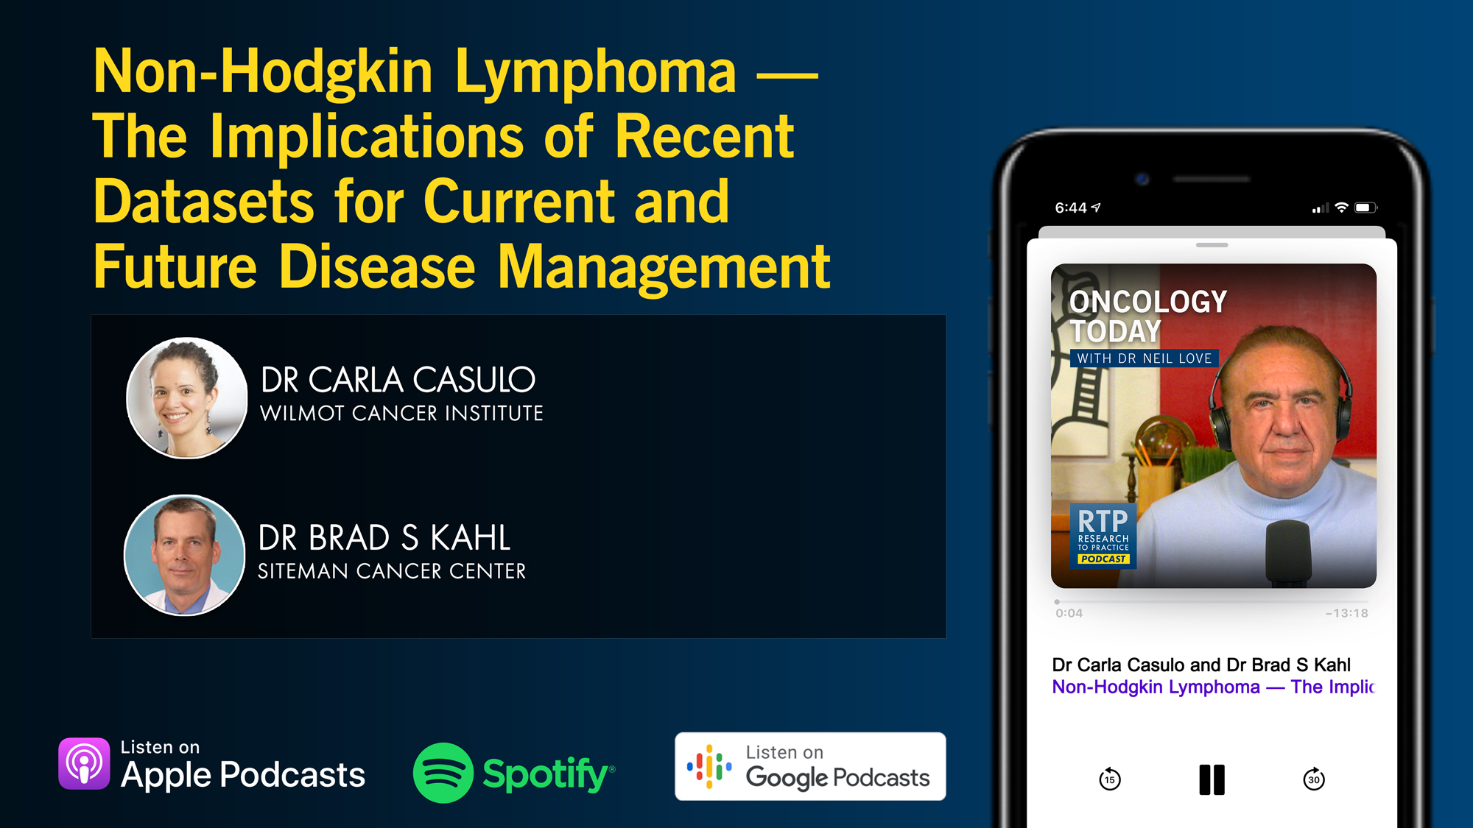

Slide 19
Cancer Conference Update: 2025 ESMO Annual Meeting — Breast Cancer Highlights
CME/MOC-Accredited Live Webinar
Thursday, November 13, 2025​ 5:00 PM – 6:30 PM ET
Faculty
Professor Giuseppe Curigliano, MD, PhD
Priyanka Sharma, MD
Moderator
Neil Love, MD

Slide 20
Practical Perspectives: Clinical Investigators Review Actual Cases of Patients with Advanced Gastroesophageal Cancers
A CME/MOC-Accredited Live Webinar
Tuesday, November 18, 2025 5:00 PM – 6:00 PM ET
Faculty
Yelena Y Janjigian, MD
Moderator
Neil Love, MD

Slide 21
Preventing and Managing Toxicities Associated with Antibody-Drug Conjugates in the Management of Metastatic Breast Cancer
A CME/MOC-Accredited Live Webinar
Wednesday, November 19, 2025 5:00 PM – 6:00 PM ET
Faculty
Lisa A Carey, MD, ScM, FASCO
Rita Nanda, MD
Moderator
Neil Love, MD

Slide 22
Cancer Conference Update: ESMO Congress 2025 — Urothelial Bladder Cancer and Prostate Cancer
A CME/MOC-Accredited Live Webinar
Thursday, November 20, 2025​ 5:00 PM – 6:00 PM ET
Faculty
Terence Friedlander, MD
Rana R McKay, MD
Moderator
Neil Love, MD

Slide 23
Exciting CME Events You Do Not Want to Miss
A Friday Satellite Symposium Series Preceding the 67th ASH Annual Meeting
Friday, December 5, 2025
Acute Myeloid Leukemia
7:30 AM – 9:30 AM ET
Myelofibrosis and Systemic Mastocytosis
3:15 PM – 5:15 PM ET
Chronic Lymphocytic Leukemia
11:30 AM – 1:30 PM ET
Follicular Lymphoma and
Diffuse Large B-Cell Lymphoma
7:00 PM – 9:00 PM ET

Slide 24
Cases from the Community: Investigators Discuss the Optimal Management of Breast Cancer
A 3-Part CME Satellite Symposium Series
Antibody-Drug Conjugates for
Metastatic Breast Cancer
Tuesday, December 9, 2025
7:00 PM – 8:30 PM CT
HER2-Positive Breast Cancer
Wednesday, December 10, 2025
7:00 PM – 9:00 PM CT
Endocrine-Based Therapy
Thursday, December 11, 2025
7:00 PM – 9:00 PM CT
Moderator
Neil Love, MD

Slide 25
Grand Rounds
CME/MOC-Accredited Interactive Series
November 2025 to April 2026
Two Series
Optimizing Treatment for Patients with Relapsed/Refractory Chronic Lymphocytic Leukemia
Optimizing the Use of Novel Therapies for Patients with Diffuse Large B-Cell Lymphoma
Host a 1-hour session at your institution: Email Meetings@ResearchToPractice.com or call (800) 233-6153

Slide 26

Save The Date
A Multitumor CME/MOC-, NCPD- and ACPE-Accredited Educational Conference Developed in Partnership with Florida Cancer Specialists & Research Institute
Friday to Sunday, April 24 to 26, 2026
The Ritz-Carlton Orlando, Grande Lakes | Orlando, Florida
Moderated by Neil Love, MD

Slide 27
Thank you for joining us! Please take a moment to complete the survey currently up on Zoom. Your feedback is very important to us. Information on how to obtain CME and ABIM MOC credit will be provided at the conclusion of the activity in the Zoom chat room. Attendees will also receive an email in 1 to 3 business days with these instructions.

Slide 28
Cancer Q&A: Understanding the Role and Reality of CAR (Chimeric Antigen Receptor) T-Cell Therapy for Non-Hodgkin Lymphoma
A CME/MOC-Accredited Webinar Developed in Partnership with CancerCare®
Wednesday, November 12, 2025 5:00 PM – 6:00 PM ET
Faculty
Jeremy S Abramson, MD, MMSc
Loretta J Nastoupil, MD
Moderator
Neil Love, MD

Slide 29
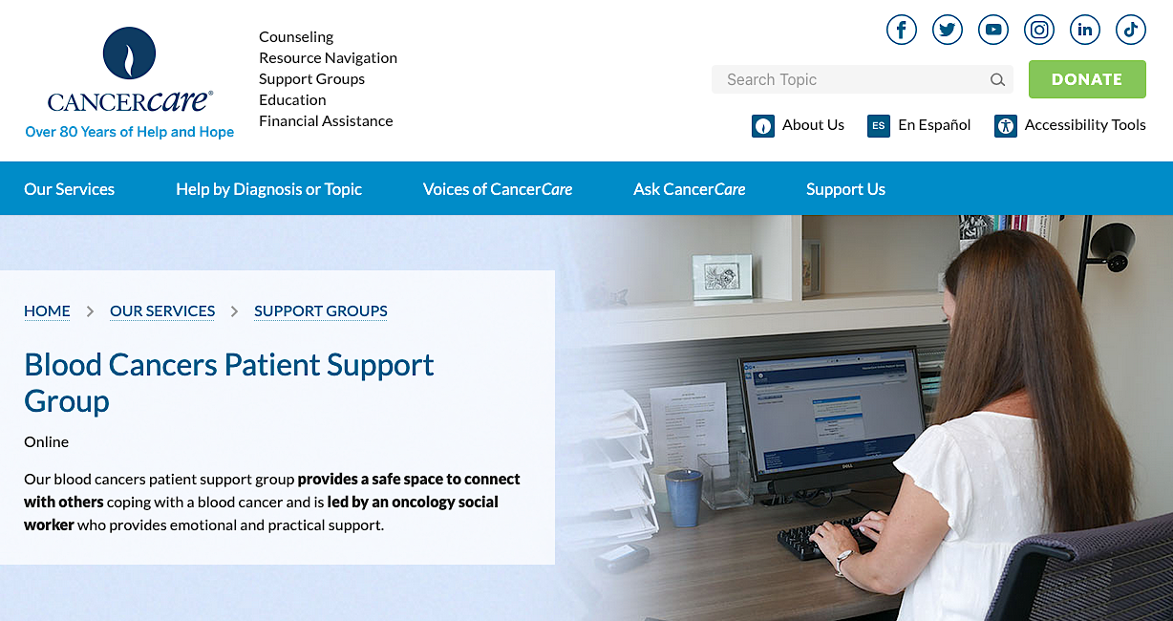

Slide 30
Faculty
Jeremy S Abramson, MD, MMSc
Director, Center for Lymphoma
Massachusetts General Hospital
Professor of Medicine
Harvard Medical School
Boston, Massachusetts
MODERATOR
Neil Love, MD Research To Practice Miami, Florida
Loretta J Nastoupil, MD
Oncologist
Southwest Oncology
CommonSpirit Mercy Hospital
Durango, Colorado

Slide 31
Survey Participants
Manali Kamdar, MD, MBBS
Associate Professor
Clinical Director of Lymphoma Services
Morton and Sandra Saffer Endowed Chair in Hematology Research
Division of Hematology, Hematologic Malignancies
University of Colorado Cancer Center
Aurora, Colorado
Tycel Phillips, MD, FASCO
Associate Professor, Division of Lymphoma
Department of Hematology and Hematopoietic Cell Transplantation
City of Hope Comprehensive Cancer Center
Duarte, California
Matthew Lunning, DO
Professor
Medical Director, Gene and Cellular Therapy
Associate Vice Chair of Research, Department of Medicine
Assistant Vice Chancellor for Clinical Research
Fred and Pamela Buffett Cancer Center
University of Nebraska Medical Center
Omaha, Nebraska
Jason Westin, MD, MS
Director, Lymphoma Clinical Research
Section Chief, Aggressive Lymphoma
Professor, Department of Lymphoma and Myeloma
The University of Texas MD Anderson Cancer Center
Houston, Texas

Slide 32
We Encourage Clinicians in Practice to Submit Questions
Feel free to submit questions now before the program begins and throughout the program.

Slide 33
Clinicians in the Audience, Please Complete the Pre- and Postmeeting Surveys
Quick Survey
Quick Poll

Slide 35
Cancer Conference Update: 2025 ESMO Annual Meeting — Breast Cancer Highlights
CME/MOC-Accredited Live Webinar
Thursday, November 13, 2025​ 5:00 PM – 6:30 PM ET
Faculty
Professor Giuseppe Curigliano, MD, PhD
Priyanka Sharma, MD
Moderator
Neil Love, MD

Slide 36
Practical Perspectives: Clinical Investigators Review Actual Cases of Patients with Advanced Gastroesophageal Cancers
A CME/MOC-Accredited Live Webinar
Tuesday, November 18, 2025 5:00 PM – 6:00 PM ET
Faculty
Yelena Y Janjigian, MD
Moderator
Neil Love, MD

Slide 37
Preventing and Managing Toxicities Associated with Antibody-Drug Conjugates in the Management of Metastatic Breast Cancer
A CME/MOC-Accredited Live Webinar
Wednesday, November 19, 2025 5:00 PM – 6:00 PM ET
Faculty
Lisa A Carey, MD, ScM, FASCO
Rita Nanda, MD
Moderator
Neil Love, MD

Slide 38
Cancer Conference Update: ESMO Congress 2025 — Urothelial Bladder Cancer and Prostate Cancer
A CME/MOC-Accredited Live Webinar
Thursday, November 20, 2025​ 5:00 PM – 6:00 PM ET
Faculty
Terence Friedlander, MD
Rana R McKay, MD
Moderator
Neil Love, MD

Slide 39
Exciting CME Events You Do Not Want to Miss
A Friday Satellite Symposium Series Preceding the 67th ASH Annual Meeting
Friday, December 5, 2025
Acute Myeloid Leukemia
7:30 AM – 9:30 AM ET
Myelofibrosis and Systemic Mastocytosis
3:15 PM – 5:15 PM ET
Chronic Lymphocytic Leukemia
11:30 AM – 1:30 PM ET
Follicular Lymphoma and
Diffuse Large B-Cell Lymphoma
7:00 PM – 9:00 PM ET

Slide 40
Cases from the Community: Investigators Discuss the Optimal Management of Breast Cancer
A 3-Part CME Satellite Symposium Series
Antibody-Drug Conjugates for
Metastatic Breast Cancer
Tuesday, December 9, 2025
7:00 PM – 8:30 PM CT
HER2-Positive Breast Cancer
Wednesday, December 10, 2025
7:00 PM – 9:00 PM CT
Endocrine-Based Therapy
Thursday, December 11, 2025
7:00 PM – 9:00 PM CT
Moderator
Neil Love, MD

Slide 41
Grand Rounds
CME/MOC-Accredited Interactive Series
November 2025 to April 2026
Two Series
Optimizing Treatment for Patients with Relapsed/Refractory Chronic Lymphocytic Leukemia
Optimizing the Use of Novel Therapies for Patients with Diffuse Large B-Cell Lymphoma
Host a 1-hour session at your institution: Email Meetings@ResearchToPractice.com or call (800) 233-6153

Slide 42
Save The Date
A Multitumor CME/MOC-, NCPD- and ACPE-Accredited Educational Conference Developed in Partnership with Florida Cancer Specialists & Research Institute
Friday to Sunday, April 24 to 26, 2026
The Ritz-Carlton Orlando, Grande Lakes | Orlando, Florida
Moderated by Neil Love, MD

Slide 43
RTP Content Distribution Platform 9-28-24 to 9-28-25
Podcast
Streaming Platforms (YouTube, Spotify)
 | Year | Month
Total (hours) | 280 | 24
Recordings | 93 | 7
Webinars | 41 | 4
Cases | 62 | 5
Meetings | 84 | 7
Final | 218 | 18
Email
Social Media
App
Website
Text Messages
QR Code Cards

Slide 44
Cancer Q&A: Understanding the Role and Reality of CAR (Chimeric Antigen Receptor) T-Cell Therapy for Non-Hodgkin Lymphoma
A CME/MOC-Accredited Webinar Developed in Partnership with CancerCare®
Wednesday, November 12, 2025 5:00 PM – 6:00 PM ET
Faculty
Jeremy S Abramson, MD, MMSc
Loretta J Nastoupil, MD
Moderator
Neil Love, MD

Slide 45
Dr Abramson — Disclosures Faculty
Consulting Agreements | AbbVie Inc, ADC Therapeutics, AstraZeneca Pharmaceuticals LP, BeOne, Bristol Myers Squibb, Celgene Corporation, Foresight Diagnostics, Genentech, a member of the Roche Group, Gilead Sciences Inc, Interius BioTherapeutics, Miltenyi Biotec, Novartis, Roche Laboratories Inc, Seagen Inc
Contracted Research | Bristol Myers Squibb, Celgene Corporation, Cellectis, Genentech, a member of the Roche Group, Merck, Mustang Bio, Regeneron Pharmaceuticals Inc, Seagen Inc, Takeda Pharmaceuticals USA Inc

Slide 46
Dr Nastoupil — Disclosures Faculty
Advisory Committees | AbbVie Inc, AstraZeneca Pharmaceuticals LP, Bristol Myers Squibb, Daiichi Sankyo Inc, Genentech, a member of the Roche Group, Genmab US Inc, Ipsen Biopharmaceuticals Inc, Janssen Biotech Inc, Kite, A Gilead Company, Merck, Novartis, Regeneron Pharmaceuticals Inc, Takeda Pharmaceuticals USA Inc
Consulting Agreements | Genentech, a member of the Roche Group
Contracted Research | BeOne, Bristol Myers Squibb, Daiichi Sankyo Inc, Genentech, a member of the Roche Group, Janssen Biotech Inc, Kite, A Gilead Company, Merck, Novartis, Takeda Pharmaceuticals USA Inc
Data and Safety Monitoring Boards/Committees | Genentech, a member of the Roche Group

Slide 47
Dr Kamdar — Disclosures Survey Participant
Consulting Agreements | AbbVie Inc, AstraZeneca Pharmaceuticals LP, BeOne, Bristol Myers Squibb, Genentech, a member of the Roche Group
Data and Safety Monitoring Boards/Committees | Bristol Myers Squibb, Genentech, a member of the Roche Group

Slide 48
Dr Lunning — Disclosures Survey Participant
Consulting/Honoraria | AbbVie Inc, Acrotech Biopharma, ADC Therapeutics, AstraZeneca Pharmaceuticals LP, Bristol Myers Squibb, Caribou Biosciences Inc, Fate Therapeutics, Genentech, a member of the Roche Group, Genmab US Inc, Incyte Corporation, Ipsen Biopharmaceuticals Inc, Janssen Biotech Inc, Kite, A Gilead Company, Loxo Oncology Inc, a wholly owned subsidiary of Eli Lilly & Company, Nurix Therapeutics Inc, Pfizer Inc, Recordati, Regeneron Pharmaceuticals Inc, Seagen Inc, Veeva, Vittoria Biotherapeutics
Research Funding | AbbVie Inc, Bristol Myers Squibb, Fate Therapeutics, Kite, A Gilead Company

Slide 49
Dr Phillips — Disclosures Survey Participant
Advisory Committees | AbbVie Inc, Genentech, a member of the Roche Group, Genmab US Inc, Merck
Consulting Agreements | AbbVie Inc, ADC Therapeutics, AstraZeneca Pharmaceuticals LP, BeOne, Bristol Myers Squibb, Caribou Biosciences Inc, Genentech, a member of the Roche Group, Genmab US Inc, Gilead Sciences Inc, Ipsen Biopharmaceuticals Inc, Janssen Biotech Inc, Kite, A Gilead Company, Lilly, Merck, Pfizer Inc, Regeneron Pharmaceuticals Inc, Xencor
Contracted Research | AbbVie Inc, Genentech, a member of the Roche Group, Sobi
Nonrelevant Financial Relationships | Blood Cancer United Scholar in Clinical Research

Slide 50
Dr Westin — Disclosures Survey Participant
Advisory Committees | Genentech, a member of the Roche Group, Kite, A Gilead Company, Novartis
Consulting Agreements | AbbVie Inc, ADC Therapeutics, Allogene Therapeutics, AstraZeneca Pharmaceuticals LP, Bristol Myers Squibb, Genentech, a member of the Roche Group, Genmab US Inc, Incyte Corporation, Janssen Biotech Inc, Kite, A Gilead Company, MorphoSys, Novartis, Nurix Therapeutics Inc, Pfizer Inc, Regeneron Pharmaceuticals Inc
Contracted Research | ADC Therapeutics, Allogene Therapeutics, AstraZeneca Pharmaceuticals LP, Bristol Myers Squibb, Genentech, a member of the Roche Group, Incyte Corporation, Janssen Biotech Inc, Kite, A Gilead Company, MorphoSys, Novartis, Nurix Therapeutics Inc, Regeneron Pharmaceuticals Inc

Slide 51
Dr Love — Disclosures
Dr Love is president and CEO of Research To Practice. Research To Practice receives funds in the form of educational grants to develop CME activities from the following companies: Aadi Bioscience, AbbVie Inc, ADC Therapeutics, Agendia Inc, Alexion Pharmaceuticals, Amgen Inc, Array BioPharma Inc, a subsidiary of Pfizer Inc, Arvinas, Astellas, AstraZeneca Pharmaceuticals LP, Aveo Pharmaceuticals, Bayer HealthCare Pharmaceuticals, BeOne, Black Diamond Therapeutics Inc, Blueprint Medicines, Boehringer Ingelheim Pharmaceuticals Inc, Bristol Myers Squibb, Celcuity, Clovis Oncology, Coherus BioSciences, Corcept Therapeutics Inc, CTI BioPharma, a Sobi Company, Daiichi Sankyo Inc, Eisai Inc, Elevation Oncology Inc, Exact Sciences Corporation, Exelixis Inc, Genentech, a member of the Roche Group, Genmab US Inc, Geron Corporation, Gilead Sciences Inc, GSK, Helsinn Therapeutics (US) Inc, Hologic Inc, ImmunoGen Inc, Incyte Corporation, Ipsen Biopharmaceuticals Inc, Jazz Pharmaceuticals Inc, Johnson & Johnson, Karyopharm Therapeutics, Kite, A Gilead Company, Kura Oncology, Legend Biotech, Lilly, MEI Pharma Inc, Merck, Mersana Therapeutics Inc, Mirati Therapeutics Inc, Mural Oncology Inc, Natera Inc, Novartis, Novartis Pharmaceuticals Corporation on behalf of Advanced Accelerator Applications, Novocure Inc, Nuvalent, Pfizer Inc, Pharmacyclics LLC, an AbbVie Company, Puma Biotechnology Inc, Regeneron Pharmaceuticals Inc, Rigel Pharmaceuticals Inc, R-Pharm US, Sanofi, Seagen Inc, Servier Pharmaceuticals LLC, SpringWorks Therapeutics Inc, Stemline Therapeutics Inc, Sumitomo Pharma America, Syndax Pharmaceuticals, Taiho Oncology Inc, Takeda Pharmaceuticals USA Inc, TerSera Therapeutics LLC, and Tesaro, A GSK Company.

Slide 52
Commercial Support
This activity is supported by educational grants from Bristol Myers Squibb and Novartis.
Research To Practice CME Planning Committee Members, Staff and Reviewers
Planners, scientific staff and independent reviewers for Research To Practice have no relevant conflicts of interest to disclose.

Slide 53
This educational activity contains discussion of non-FDA-approved uses of agents and regimens. Please refer to official prescribing information for each product for approved indications.

Slide 54
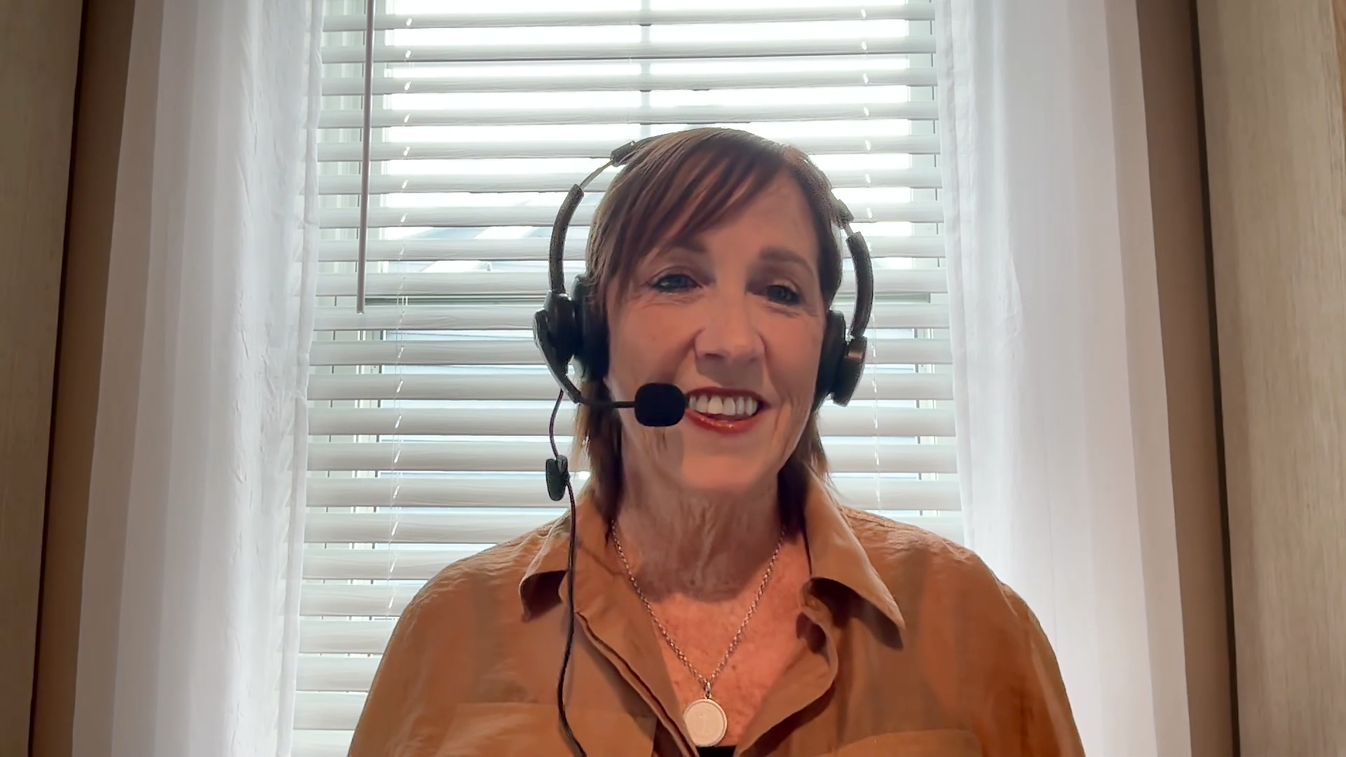
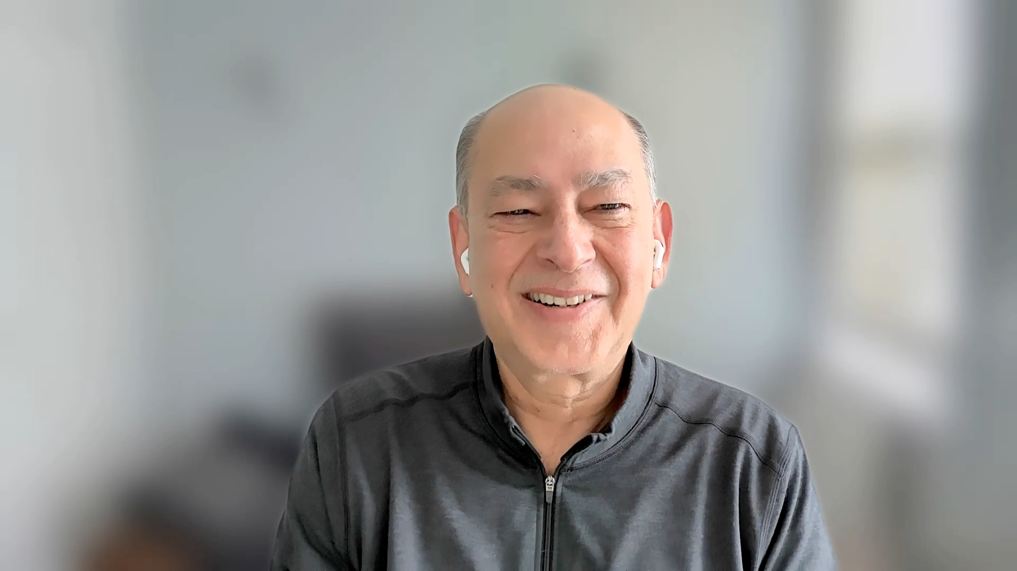
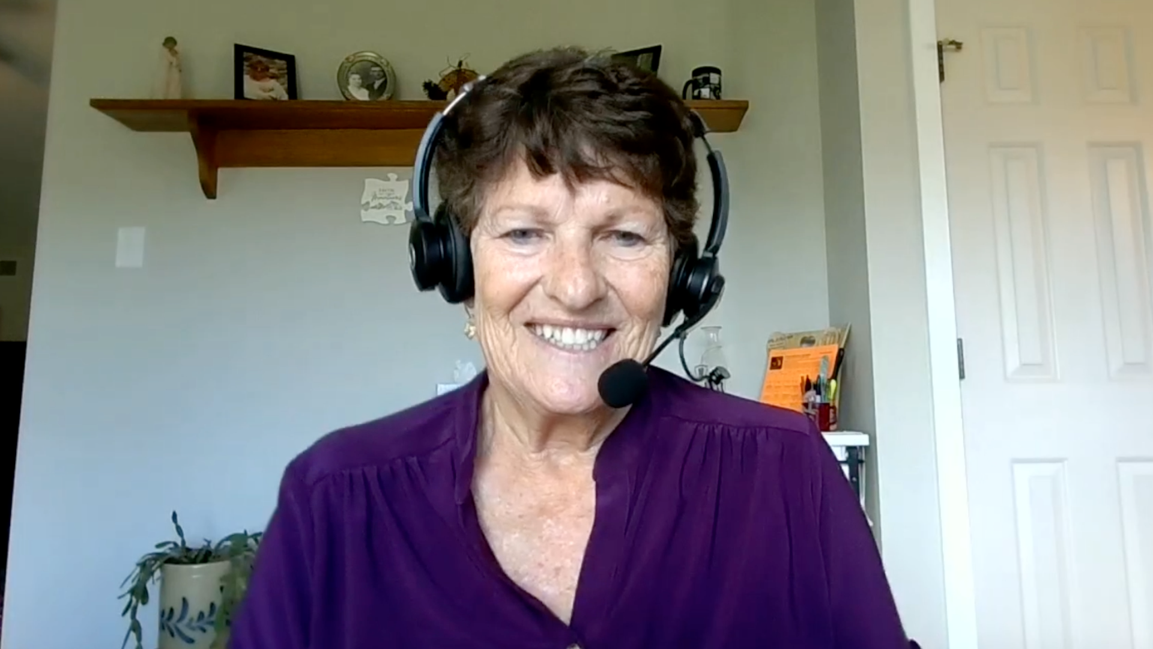
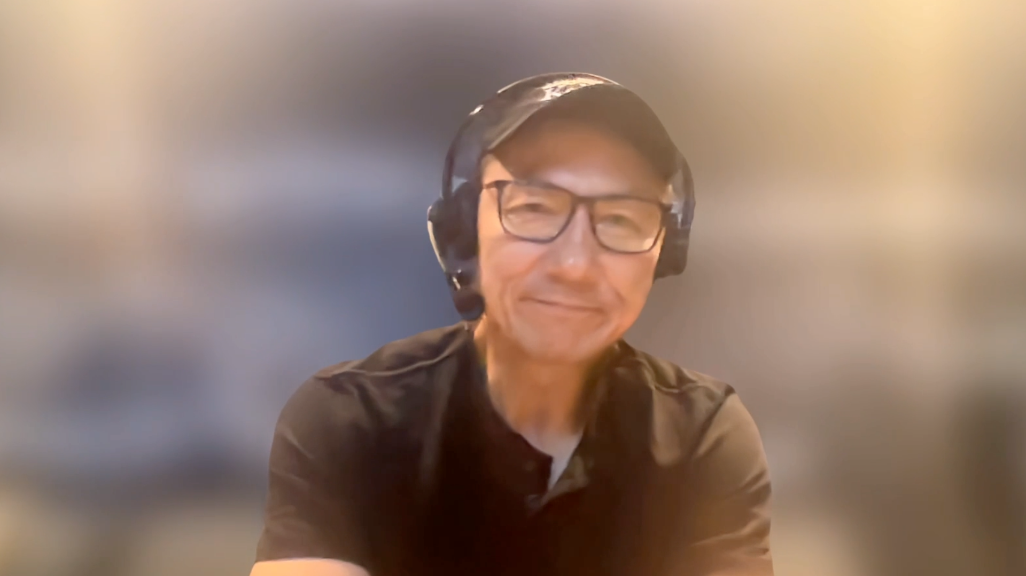
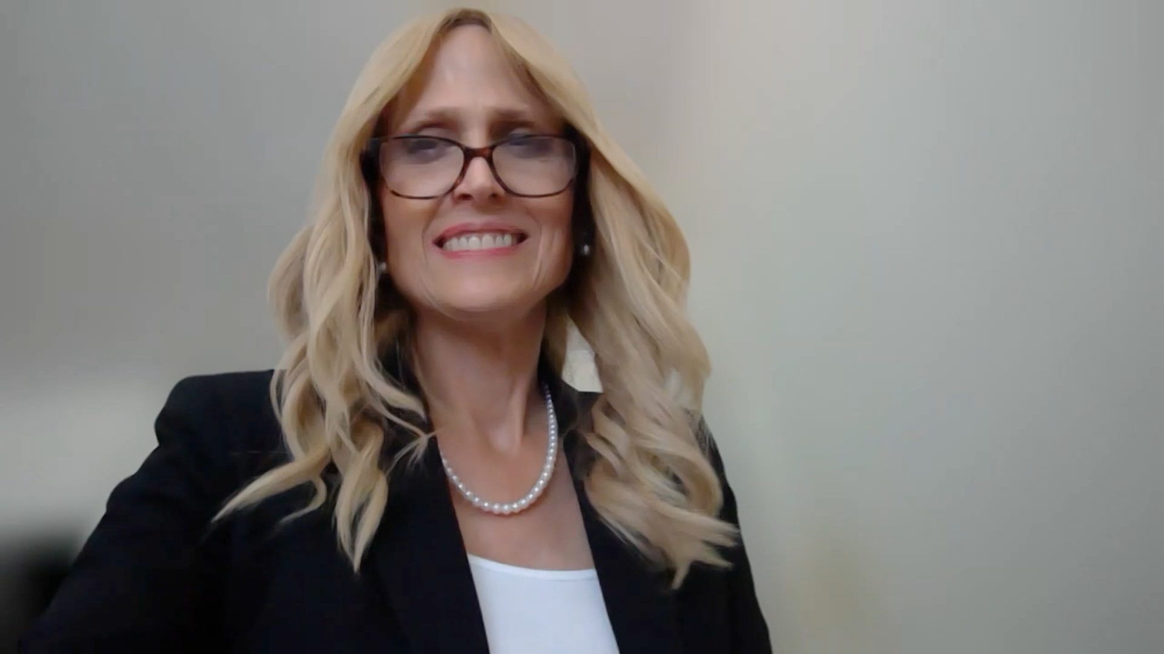
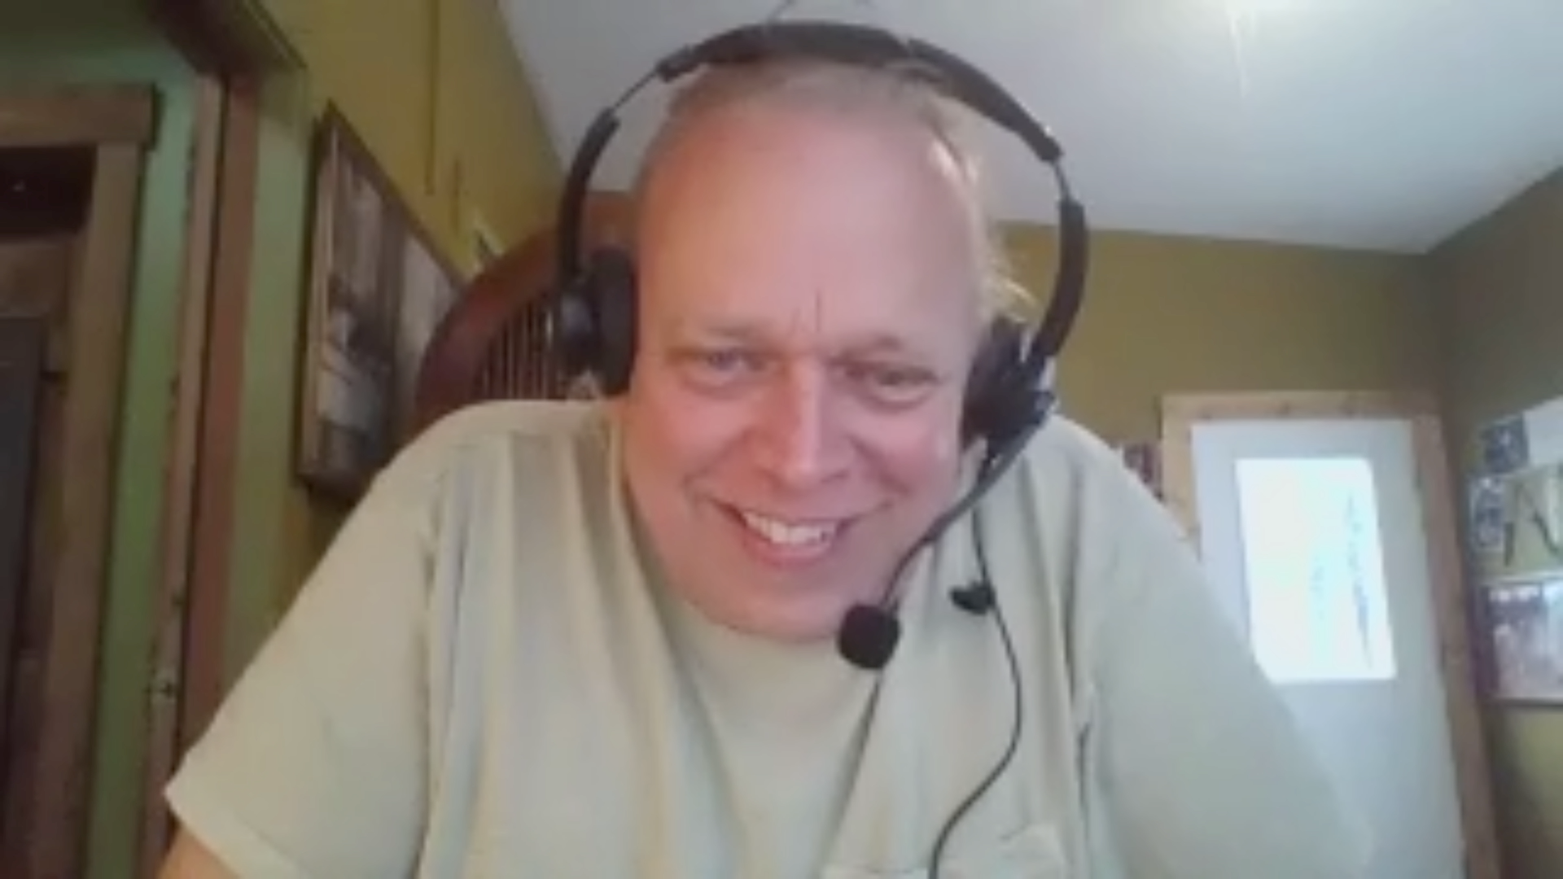
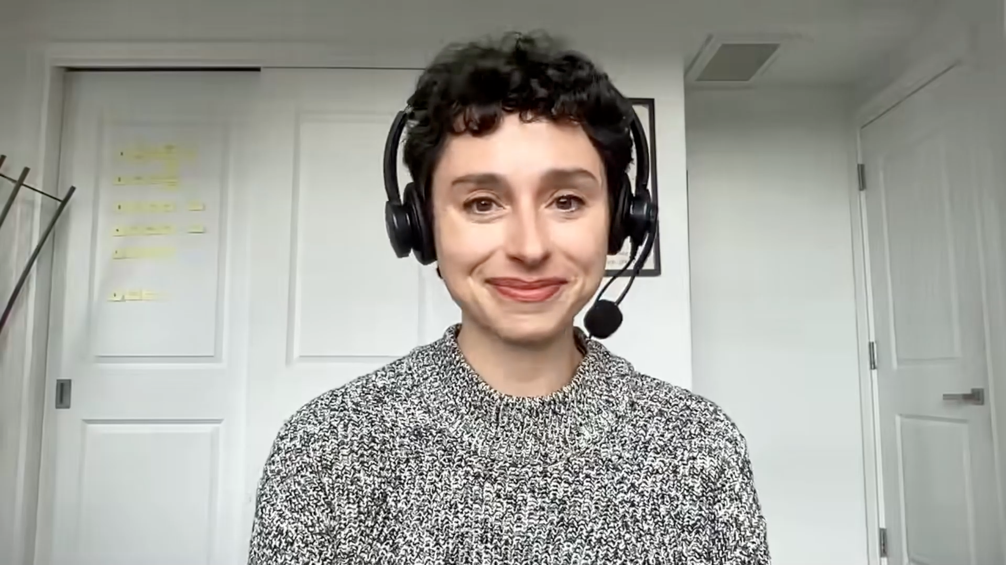
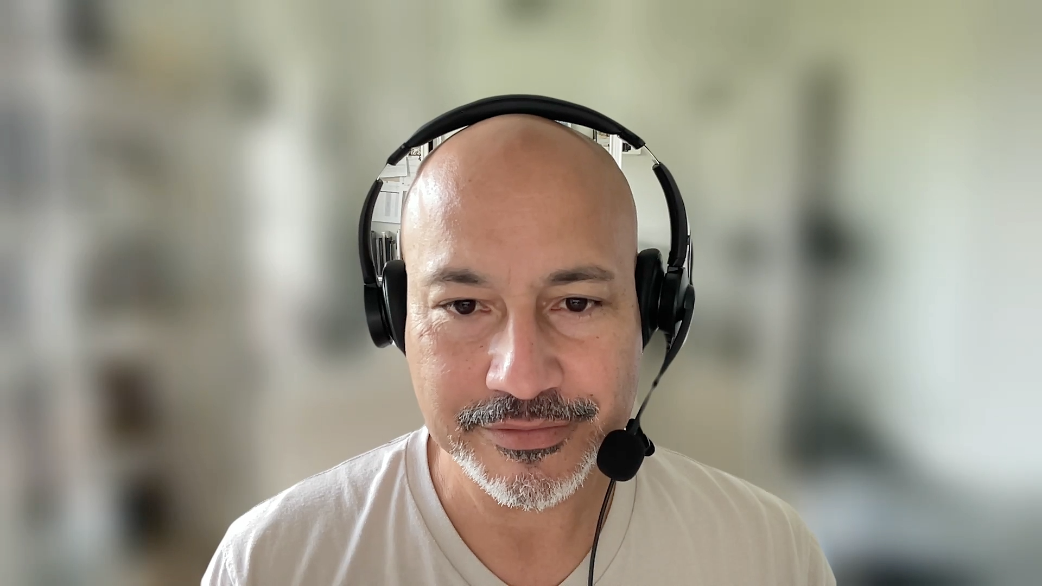

Slide 55
Cancer Q&A CAR T-Cell Therapy for Non-Hodgkin Lymphoma
Module 1: Overview of CAR T-Cell Therapy
Module 2: Potential Treatment Benefits of CAR T-Cell Therapy
Module 3: CRS (Cytokine Release Syndrome) and ICANS (Immune Effector Cell-Associated Neurotoxicity Syndrome)
Module 4: Finding Information About CAR T-Cell Therapy; Clinical Trials
Module 5: Financial Issues; Risk of Infection
Module 6: Coping with Anxiety; Healing and Moving On

Slide 56
Cancer Q&A CAR T-Cell Therapy for Non-Hodgkin Lymphoma
Module 1: Overview of CAR T-Cell Therapy
Module 2: Potential Treatment Benefits of CAR T-Cell Therapy
Module 3: CRS (Cytokine Release Syndrome) and ICANS (Immune Effector Cell-Associated Neurotoxicity Syndrome)
Module 4: Finding Information About CAR T-Cell Therapy; Clinical Trials
Module 5: Financial Issues; Risk of Infection
Module 6: Coping with Anxiety; Healing and Moving On

Slide 57
Overview of CAR T-cell therapy

Slide 58
Overview of CAR T-Cell Treatment
CAR T cells harness the power of your own immune system to fight the lymphoma. Both CAR T-cell products have identical efficacy. One is less toxic but takes about a week longer to manufacture.
Liso-cel is generally associated with lower rates of CRS and neurotoxicity. The one limitation is the median manufacturing time is about 24 days.
Cytopenias, secondary malignancy risk and infection risk are similar across constructs. Manufacturing time is different across different products.
I often start with the fact that no head-to-head trials are comparing CAR T for third line plus as well as high risk second-line population. I pay a lot of attention on mitigating the risk of high-grade toxicity, which I feel leads to long-term disability and length of stay issues.
All CAR products are derived from the patients own T cells. They are modified to better recognize and kill cancer cells. Axi-cel/brexu-cel has a Ferrari engine; Liso-cel and tis-cel have a Corvette engine.
The approved products are very similar – we take T cells and turn them in to lymphoma-fighting weapons, which are more effective to get and stay in remission than other treatments. The main differences are logistics and side effects.
CRS = cytokine release syndrome; CAR T = CAR T-cell therapy

Slide 59
Discussion Question
Of the patients with NHL who you would consider to be good candidates for CAR-T therapy, what fraction end up being evaluated by a CAR-T center and what fraction of those patients actually receive treatment?

Slide 60
Key Time Points in the CAR T-Cell Therapy Journey Manali Kamdar, MD, MBBS
I map out the process clearly:
Initial consult and eligibility review
Apheresis (cell collection)
Bridging therapy (if needed)
Manufacturing period (usually 3-5 weeks)
Lymphodepleting chemotherapy
Cell infusion (day 0)
Monitoring phase (days 0-14) for CRS or ICANS
Response assessment at day 30 or 90, depending on institutional programmatic approach
Follow-up phase: infection prophylaxis, labs and clinic visits for at least 6 months
I reassure them that if the first 2 weeks go smoothly, they can often transition home or to local lodging, continuing close follow-up.

Slide 61
Key Timepoints in the CAR T-Cell Therapy Journey
CAR T cells are a multi-step process, but the actual treatment is given as a single infusion, not multiple cycles like many other therapies.
Patients are monitored at the treating center until they are deemed safe to return home. Patients are followed closely for the first 90 days.
I map out the process clearly. I reassure them that if the first 2 weeks go smoothly, they can often transition home or local lodging, continuing close follow-up.
Brain to Vein encapsulates desire to do it and actually getting to go to apheresis. The challenge here is insurance approval, tests necessary, and getting a chair for apheresis. Once apheresed then we are in the Vein to Vein time, which we very reliably now infuse products to near 100%.
The first step is insurance approval. This can vary from patient to patient. Next step after approval is obtaining an apheresis slot, for which thereafter we will collect cells.
The key time points are the decision, the approval, the collection, the manufacturing, the delivery, and the follow-up. For follow-up, patients have testing like PET/CT scans and blood work, and to work with their local oncologist on recovering from any leftover side effects.

Slide 62
Discussion Question
What is the role of bridging therapy? Adding in systemic treatment (eg, a Bruton tyrosine kinase inhibitor)?

Slide 63
Bridging Therapy
Bridging therapy is treatment used to control the disease and symptoms while the CAR T cells are being manufactured. We have both systemic options and radiation therapy.
Patients are likely to have better outcomes regarding both safety and efficacy if they proceed with CAR T with disease regressing as opposed to progressing.
Bridging therapy is anything we do to stabilize disease while CAR T cells are being manufactured. The goal is to keep the disease under control.
I use apheresis as a split in bridging as I may do something different before apheresis (pre-aph) and after apheresis (post-aph). In pre-aph, I focus on disease stabilization without making them too sick for CAR T. In the post-aph period we use what we’ve learned to customize therapy.
Bridging therapy is needed to slow the progression of cancer long enough to allow for collection, manufacture and return of the CAR product; especially helpful for rapidly progressive disease.
Bridging therapy is not always required, especially if the amount of lymphoma is low and speed of disease growth is slow.
CAR T = CAR T-cell therapy

Slide 64
Discussion Question
How do you select a CAR-T product? What is the relative efficacy and efficiency of product preparations, and what are their associated toxicities?

Slide 65
Selecting a CAR T-Cell Therapy Product Manali Kamdar, MD, MBBS
When I choose a CAR-T product, I consider:
Disease subtype and efficacy data for that construct in that histology
Tumor burden, patient symptoms, time it will take to manufacture one construct versus the other
Patient profile: age, comorbidities, performance status, caregiver support
Logistics: inpatient versus outpatient feasibility, manufacturing time and caregiver support
The goal is to tailor the product to both disease biology and patient resilience.

Slide 66
Selecting a CAR T-Cell Therapy Product
We consider multiple factors, including efficacy, safety, manufacturing time and ability to administer in the outpatient setting.
Key factors are type of lymphoma, line of therapy, response to prior treatment, comorbid conditions, disease burden and tempo.
I consider disease subtype, efficacy data, tumour burden, patient symptoms, time it will take to manufacture, patient age, comorbidities, performance status, caregiver support.
I look at it backwards: high-grade ICANS and then work my way backwards, next being high-grade CRS — we’ve gotten so much better at managing CRS that it is quite rare. In the end, I believe liso-cel checks the box of balance with efficacy vs safety.
Liso-cel is appropriate alternative to axi-cel for DLBCL. For a patient w/ high burden or aggressive disease the choice might be axi-cel. For FL, the preference is liso-cel. For MCL the preference is brexu-cel.
I weigh the pros and cons of each product: If the disease is progressing quickly, I choose speed and reliability of manufacturing. If the patient is frail, I choose safety of the toxicity profile.

Slide 67
Cancer Q&A CAR T-Cell Therapy for Non-Hodgkin Lymphoma
Module 1: Overview of CAR T-Cell Therapy
Module 2: Potential Treatment Benefits of CAR T-Cell Therapy
Module 3: CRS (Cytokine Release Syndrome) and ICANS (Immune Effector Cell-Associated Neurotoxicity Syndrome)
Module 4: Finding Information About CAR T-Cell Therapy; Clinical Trials
Module 5: Financial Issues; Risk of Infection
Module 6: Coping with Anxiety; Healing and Moving On

Slide 68
Potential treatment benefits of CAR T-cell therapy

Slide 69
Discussion Question
What are the projected benefits of CAR T-cell therapy in diffuse large B-cell lymphoma? Where does CAR T fit in?

Slide 70
Diffuse Large B-Cell Lymphoma (DLBCL)
The majority of patients will respond; about half will go into complete remission. Close to 40% will be cured.
I generally favor liso-cel for older or frailer patients given the favorable toxicity profile. For young, fit patients, I prefer axi-cel with the favorable manufacturing time.
I generally prefer liso-cel for DLBCL. The 5-year follow-up data across all constructs suggest a roughly 40% chance of long-term remission or cure, but liso-cel has a more favorable safety profile.
I would prefer liso-cel, given its balance of efficacy and safety in multiply relapsed DLBCL. I do believe it carries the least likelihood of having high-grade neurotoxicity compared to the other products.
Preference would be based on age/fitness; for younger/fit patients axi-cel and for older patients liso-cel. This would be administered w/ the intent to cure. Patients in remission at day 90 have a great chance of long-term cure.
Axi-cel. For your relapsed DLBCL, we have one chance to provide a curative intent therapy and thus reliability of manufacturing is key. Axi-cel cures about 40% of patients with this otherwise fatal disease.

Slide 71
Discussion Question
What are the projected benefits of CAR T-cell therapy for follicular lymphoma? Where does CAR T fit in?

Slide 72
Follicular Lymphoma (FL)
Responses to CAR T last about 5 years on average, but far longer responses are possible. Some patients will never relapse after this treatment.
I recommend liso-cel primarily because it is associated with a manageable safety profile.
My preferred CAR T is lisocabtagene maraleucel (liso-cel), which offers an attractive balance of efficacy and tolerability. Remission can be long-lasting — and possibly curative.
Despite longer data and follow-up with axi-cel, I do feel that the toxicity profile matters as FL is a marathon, not a sprint. I would consider liso-cel, which has excellent activity in obtaining a complete response.
My preference is liso-cel; the hope is that w/ time we might identify a subset of patients that could potentially achieve a cure or a “functional” cure.
Axi-cel. We choose this treatment because more than half of patients are alive and did not require additional lymphoma therapy with more than 5 years of follow up – hopefully some of those patients are cured.

Slide 73
Discussion Question
What are the projected benefits of CAR T-cell therapy for mantle cell lymphoma? Where does CAR T fit in?

Slide 74
Mantle Cell Lymphoma (MCL)
The vast majority of patients in this situation will respond, and most will go into complete remission. Remissions last 1-2 years on average, but remission may last much longer. Pirtobrutinib may be used as bridging therapy.
I would prefer liso-cel for multiply-relapsed MCL. I would favor brexu-cel for a young, fit patient with high-risk disease in first relapse.
For younger, fit patients, brexucabtagene autoleucel (brexu-cel) remains my preferred choice. For older or frail patients, I favor liso-cel due to its lower toxicity and outpatient feasibility.
Considering the activity of both in mantle cell lymphoma post-BTK exposure, I would prefer Liso-cel over Brexu-cel due to its safety profile, noting the differences in these single-arm trials.
Preference is brexu-cel. Treatment is not curative and the disease will relapse. For those unable to receive brexu-cel we use liso-cel.
Liso-cel. For your relapsed MCL, we want to balance concerns for effective treatment and risk of side effects. The other options are impressive, but have a higher risk of severe side effects.

Slide 75
Cancer Q&A CAR T-Cell Therapy for Non-Hodgkin Lymphoma
Module 1: Overview of CAR T-Cell Therapy
Module 2: Potential Treatment Benefits of CAR T-Cell Therapy
Module 3: CRS (Cytokine Release Syndrome) and ICANS (Immune Effector Cell-Associated Neurotoxicity Syndrome)
Module 4: Finding Information About CAR T-Cell Therapy; Clinical Trials
Module 5: Financial Issues; Risk of Infection
Module 6: Coping with Anxiety; Healing and Moving On

Slide 76
CRS (cytokine release syndrome) and ICANS (immune effector cell-associated neurotoxicity syndrome)

Slide 77
Discussion Question
What is the clinical spectrum of CRS? Role of preemptive tocilizumab?

Slide 78
CRS
The most common symptom is fever, but it can uncommonly get worse. We give an antidote called tocilizumab with or without steroids which rapidly improves the CRS and usually prevents if from becoming severe.
The spectrum of CRS is dependent on the product regarding the likelihood of experiencing it at all and how serious it might be. Nearly all patients will have fever. Generally, the course of CRS is relatively short.
I describe CRS as the “immune storm” that tells us the CARs are expanding — fever, chills, low blood pressure, shortness of breath — ranging from mild to severe.
High-grade CRS, I would argue, is less common now than high-grade ICANS. I focus on discussing if we see CRS, especially if early post-infusion, we act quickly as I believe this is the biggest predictor of odds of having ICANS.
CRS is manifested by fever but this is generally preceded by tachycardia. Some patients require ICU.
I describe CRS as similar to having an infection like the flu — sometimes you can have fever and body aches and that’s it, other times you can see low blood pressure and a trip to the ICU.

Slide 79
Discussion Question
What is the clinical spectrum of ICANS and other neurotoxicities? How are these managed?

Slide 80
ICANS
The most common symptoms are confusion, sleepiness or word-finding difficulties.
ICANS is variable and unpredictable. It generally will occur after a patient has experienced CRS. It can be rapid in onset and resolution.
ICANS often follows or overlaps with CRS, most commonly within 8-14 days post infusion. Early recognition is key, and we maintain daily neurologic checks during the acute phase.
If ICANS does occur I’ve already readied them for a longer inpatient stay and that they may need acute rehab. We do steroids prophylaxis and are very aggressive with CRS management if CRS onset in first 72 post-infusion.
Initial management is w/ steroids and depends on severity and duration of symptoms. For most patients this is reversible.
ICANS is brain dysfunction, which is nearly always reversible. There are no effective preventative strategies, and treatments can prevent ICANS from worsening.

Slide 81
Cancer Q&A CAR T-Cell Therapy for Non-Hodgkin Lymphoma
Module 1: Overview of CAR T-Cell Therapy
Module 2: Potential Treatment Benefits of CAR T-Cell Therapy
Module 3: CRS (Cytokine Release Syndrome) and ICANS (Immune Effector Cell-Associated Neurotoxicity Syndrome)
Module 4: Finding Information About CAR T-Cell Therapy; Clinical Trials
Module 5: Financial Issues; Risk of Infection
Module 6: Coping with Anxiety; Healing and Moving On

Slide 82
Finding information about CAR T-cell therapy; clinical trials

Slide 83
Discussion Question
What is known about mechanisms of resistance and clinical limitations to CAR T-cell therapy, and what research avenues are being pursued to improve it?
What are some of the exciting clinical trial initiatives in CAR T-cell therapy?

Slide 84
Cancer Q&A CAR T-Cell Therapy for Non-Hodgkin Lymphoma
Module 1: Overview of CAR T-Cell Therapy
Module 2: Potential Treatment Benefits of CAR T-Cell Therapy
Module 3: CRS (Cytokine Release Syndrome) and ICANS (Immune Effector Cell-Associated Neurotoxicity Syndrome)
Module 4: Finding Information About CAR T-Cell Therapy; Clinical Trials
Module 5: Financial Issues; Risk of Infection
Module 6: Coping with Anxiety; Healing and Moving On

Slide 85
Financial issues; risk of infection

Slide 86
Discussion Question
What are some of the financial issues that arise with CAR T-cell therapy? Outpatient CAR T?

Slide 87
Financial Issues
Insurance covers the CAR T cells and associated care. Costs may be associated with needing to stay near our center for 2-4 weeks, but support and reimbursement programs are available.
Insurance coverage may impact which centers are available and this can result in long travel. Patients have several visits to the treating center and are generally not able to work and this too can be a financial stressor.
I emphasize the importance of caregiver support, possible work or income disruption, and the option of FMLA for caregivers. Financial counselors and social workers assist.
Medicare with managed plan or private insurance requires single-case agreement, which delays apheresis. I know what insurance they have before I walk into the consult room as that may impact my Brain to Vein decision. Rarely after that is it an issue.
Work can be an important issue. Also, there is need for a caregiver, which requires another person to be off work for an extended period, which for some is not financially feasible.
As anything complicated, CAR-T treatment can have financial challenges, like needing to be away from home for monitoring and needing to have a caregiver(s) to take off work.

Slide 88
Discussion Question
What are some of the long-term issues with CAR T-cell therapy, including hypogammaglobulinemia, infections, preemptive antimicrobials and vaccines?

Slide 89
Potential Long-Term Complications
Prophylactic antibiotics are used until healthy lymphocytes have recovered. We also monitor antibody levels, and may use IVIG. We will also consider vaccines to help prevent infections.
B-cell depletion can increase the risk of infection, particularly viral infections. Monitoring IgG levels and IVIG replacement is also a consideration to reduce the risk of infection.
The primary concern is immunosuppression and infection risk due to prolonged B-cell aplasia and hypogammaglobulinemia. I keep patients on antiviral and PJP prophylaxis for at least 6 months.
We use anti-infection prophylaxis, but I don’t do IVIG post-CAR T without infection. Secondary malignancies are real, but it is way more myeloid than T-cell concerns.
We continue anti-infection prophylaxis until blood count recovery.
CAR T cells kill B cells, both good and bad ones, and not having good B cells for months afterwards can open you up to unusual infections.
IVIG = intravenous immunoglobulin; PJP = Pneumocystis jirovecii pneumonia; CAR T = CAR T-cell therapy

Slide 90
Discussion Question
Are there complementary strategies that are useful in managing toxicities with CAR T-cell therapy?

Slide 91
Cancer Q&A CAR T-Cell Therapy for Non-Hodgkin Lymphoma
Module 1: Overview of CAR T-Cell Therapy
Module 2: Potential Treatment Benefits of CAR T-Cell Therapy
Module 3: CRS (Cytokine Release Syndrome) and ICANS (Immune Effector Cell-Associated Neurotoxicity Syndrome)
Module 4: Finding Information About CAR T-Cell Therapy; Clinical Trials
Module 5: Financial Issues; Risk of Infection
Module 6: Coping with Anxiety; Healing and Moving On

Slide 92
Coping with anxiety; healing and moving on

Slide 93
Discussion Question
What advice do you give to patients and families to cope with anxiety and depression?

Slide 95
Cancer Conference Update: 2025 ESMO Annual Meeting — Breast Cancer Highlights
CME/MOC-Accredited Live Webinar
Thursday, November 13, 2025​ 5:00 PM – 6:30 PM ET
Faculty
Professor Giuseppe Curigliano, MD, PhD
Priyanka Sharma, MD
Moderator
Neil Love, MD

Slide 96
Thank you for joining us! Please take a moment to complete the survey currently up on Zoom. Your feedback is very important to us. The survey will remain open for 5 minutes after the meeting ends. Information on how to obtain CME and ABIM MOC credit is provided in the Zoom chat room. Attendees will also receive an email in 1 to 3 business days with these instructions.

