Slide 1
Expert Second Opinion
Investigators Discuss the Role of Novel Treatment Approaches in the Care of Patients with Follicular Lymphoma and Diffuse Large B-Cell Lymphoma
A CME-Accredited Friday Satellite Symposium Preceding the 67th ASH Annual Meeting
Friday, December 5, 2025
7:00 PM – 9:00 PM ET
Faculty
Nancy L Bartlett, MD
John P Leonard, MD
Matthew Matasar, MD
Loretta J Nastoupil, MD
Professor Pier Luigi Zinzani
Moderator
Neil Love, MD

Slide 2

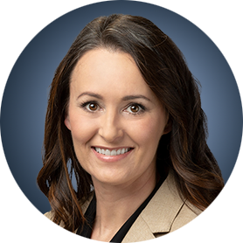



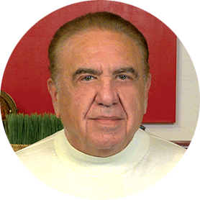
Faculty
Nancy L Bartlett, MD
Professor of Medicine
Koman Chair in Medical Oncology
Washington University School of Medicine
St Louis, Missouri
Loretta J Nastoupil, MD
Oncologist
Southwest Oncology
CommonSpirit Mercy Hospital
Durango, Colorado
John P Leonard, MD
Laura and Isaac Perlmutter Professor of Hematology and Medical Oncology
Director, Division of Hematology and Medical Oncology
Director, Center for Blood Cancers
Senior Advisor to the Dean/CEO and Chief Clinical Officer
for Enterprise Cancer Strategy and Operations
Interim Director, Laura and Isaac Perlmutter Cancer Center
NYU Grossman School of Medicine
NYU Langone Health
New York, New York
Professor Pier Luigi Zinzani
Professor of Hematology
Alma Mater Studiorum — University of Bologna
Head, “Seràgnoli” Institute of Hematology
IRCCS Azienda Ospedaliero-Universitaria di Bologna
Department of Medical and Surgical Sciences
Bologna University School of Medicine
Bologna, Italy
Matthew Matasar, MD
Chief, Division of Blood Disorders
Rutgers Cancer Institute
Hematologist/Oncologist
Professor
Rutgers Robert Wood Johnson Medical School
New Brunswick, New Jersey
Moderator
Neil Love, MD
Research To Practice
Miami, Florida

Slide 3
Dr Bartlett — Disclosures
Faculty
Advisory Committees | AbbVie Inc, Genentech, a member of the Roche Group, Genmab US Inc, Kite, A Gilead Company, Pfizer Inc, Seagen Inc
Contracted Research | AbbVie Inc, ADC Therapeutics, Autolus, Bristol Myers Squibb, Celgene Corporation, Forty Seven Inc, Genentech, a member of the Roche Group, Genmab US Inc, Gilead Sciences Inc, Kite, A Gilead Company, Pfizer Inc, Pharmacyclics LLC, an AbbVie Company, Seagen Inc, Takeda Pharmaceuticals USA Inc

Slide 4
Dr Leonard — Disclosures
Faculty
Consulting Agreements | AstraZeneca Pharmaceuticals LP, BeOne, Bristol Myers Squibb, Caribou Biosciences Inc, Eisai Inc, Foresight Diagnostics, Genentech, a member of the Roche Group, Grail Inc, Kyowa Kirin Co Ltd, Novartis, Ono Pharmaceutical Co Ltd, Pfizer Inc, Regeneron Pharmaceuticals Inc, Sail Biomedicines, Teva Pharmaceutical Industries Ltd, Treeline Biosciences
Contracted Research | Ipsen Biopharmaceuticals Inc, Janssen Biotech Inc
Data and Safety Monitoring Boards/Committees | BeOne, Genentech, a member of the Roche Group
Stock Options — Private Companies | Treeline Biosciences

Slide 5
Dr Matasar — Disclosures
Faculty
Advisory Committees | Allogene Therapeutics, Arvinas, Bristol Myers Squibb, Genentech, a member of the Roche Group, Genmab US Inc, Merck
Consulting Agreements | AbbVie Inc, Genentech, a member of the Roche Group, Novartis, Pfizer Inc, Roche Laboratories Inc
Contracted Research | Genentech, a member of the Roche Group, Janssen Biotech Inc, Pfizer Inc, Roche Laboratories Inc
Honoraria and Stipends | ADC Therapeutics, AstraZeneca Pharmaceuticals LP, Ipsen Biopharmaceuticals Inc, Kite, A Gilead Company, Regeneron Pharmaceuticals Inc
Stock Ownership — Public Companies | Merck

Slide 6
Dr Nastoupil — Disclosures
Faculty
Advisory Committees | AbbVie Inc, AstraZeneca Pharmaceuticals LP, Bristol Myers Squibb, Daiichi Sankyo Inc, Genentech, a member of the Roche Group, Genmab US Inc, Ipsen Biopharmaceuticals Inc, Janssen Biotech Inc, Kite, A Gilead Company, Merck, Novartis, Regeneron Pharmaceuticals Inc, Takeda Pharmaceuticals USA Inc
Consulting Agreements | Genentech, a member of the Roche Group
Contracted Research | BeOne, Bristol Myers Squibb, Daiichi Sankyo Inc, Genentech, a member of the Roche Group, Janssen Biotech Inc, Kite, A Gilead Company, Merck, Novartis, Takeda Pharmaceuticals USA Inc
Data and Safety Monitoring Boards/Committees | Genentech, a member of the Roche Group

Slide 7
Prof Zinzani — Disclosures
Faculty
Advisory Committees | AbbVie Inc, AstraZeneca Pharmaceuticals LP, BeOne, Bristol Myers Squibb, Gilead Sciences Inc, Incyte Corporation, Janssen Biotech Inc, Kyowa Kirin Co Ltd, Novartis, Recordati, Roche Laboratories Inc, Sobi, Takeda
Speakers Bureaus | AbbVie Inc, AstraZeneca Pharmaceuticals LP, BeOne, Bristol Myers Squibb, Gilead Sciences Inc, Incyte Corporation, Janssen Biotech Inc, Kyowa Kirin Co Ltd, Merck, Novartis, Recordati, Roche Laboratories Inc, Sobi, Takeda

Slide 8
Dr Love — Disclosures
Dr Love is president and CEO of Research To Practice. Research To Practice receives funds in the form of educational grants to develop CME activities from the following companies: Aadi Bioscience, AbbVie Inc, ADC Therapeutics, Agendia Inc, Alexion Pharmaceuticals, Amgen Inc, Array BioPharma Inc, a subsidiary of Pfizer Inc, Arvinas, Astellas, AstraZeneca Pharmaceuticals LP, Aveo Pharmaceuticals, Bayer HealthCare Pharmaceuticals, BeOne, Black Diamond Therapeutics Inc, Blueprint Medicines, Boehringer Ingelheim Pharmaceuticals Inc, Bristol Myers Squibb, Celcuity, Clovis Oncology, Coherus BioSciences, Corcept Therapeutics Inc, CTI BioPharma, a Sobi Company, Daiichi Sankyo Inc, Eisai Inc, Elevation Oncology Inc, Exact Sciences Corporation, Exelixis Inc, Genentech, a member of the Roche Group, Genmab US Inc, Geron Corporation, Gilead Sciences Inc, GSK, Helsinn Therapeutics (US) Inc, Hologic Inc, ImmunoGen Inc, Incyte Corporation, Ipsen Biopharmaceuticals Inc, Jazz Pharmaceuticals Inc, Johnson & Johnson, Karyopharm Therapeutics, Kite, A Gilead Company, Kura Oncology, Legend Biotech, Lilly, MEI Pharma Inc, Merck, Mersana Therapeutics Inc, Mirati Therapeutics Inc, Mural Oncology Inc, Natera Inc, Novartis, Novartis Pharmaceuticals Corporation on behalf of Advanced Accelerator Applications, Novocure Inc, Nuvalent, Pfizer Inc, Pharmacyclics LLC, an AbbVie Company, Puma Biotechnology Inc, Regeneron Pharmaceuticals Inc, Rigel Pharmaceuticals Inc, R-Pharm US, Sanofi, Seagen Inc, Servier Pharmaceuticals LLC, SpringWorks Therapeutics Inc, Stemline Therapeutics Inc, Sumitomo Pharma America, Syndax Pharmaceuticals, Taiho Oncology Inc, Takeda Pharmaceuticals USA Inc, TerSera Therapeutics LLC, and Tesaro, A GSK Company.

Slide 9
Commercial Support
This activity is supported by educational grants from ADC Therapeutics, Genentech, a member of the Roche Group, Incyte Corporation, and Pfizer Inc.
Research To Practice CME Planning Committee Members,
Staff and Reviewers
Planners, scientific staff and independent reviewers for Research To Practice have no relevant conflicts of interest to disclose.

Slide 10
This educational activity contains discussion of
non-FDA-approved uses of agents and regimens. Please refer to official prescribing information for each product for approved indications.

Slide 11
CASES FROM THE COMMUNITY
Investigators Discuss the Role of Antibody-Drug
Conjugates in the Management of Triple-Negative and HR-Positive Metastatic Breast Cancer
Part 1 of a 3-Part CME Satellite Symposium Series
Tuesday, December 9, 2025
7:00 PM – 8:30 PM CT (8:00 PM – 9:30 PM ET)
Faculty
Javier Cortés, MD, PhD
Rita Nanda, MD
Professor Peter Schmid, FRCP, MD, PhD
Priyanka Sharma, MD
Moderator
Neil Love, MD

Slide 12
CASES FROM THE COMMUNITY
Investigators Discuss the Optimal Management of HER2-Positive Breast Cancer
Part 2 of a 3-Part CME Satellite Symposium Series
Wednesday, December 10, 2025
7:00 PM – 9:00 PM CT (8:00 PM – 10:00 PM ET)
Faculty
Professor Giuseppe Curigliano, MD, PhD
Nadia Harbeck, MD, PhD
Ian E Krop, MD, PhD
Nancy U Lin, MD
Joyce O’Shaughnessy, MD
Moderator
Neil Love, MD

Slide 13
CASES FROM THE COMMUNITY
Investigators Discuss the Optimal Role of
Endocrine-Based and Other Strategies in the
Management of HR-Positive Breast Cancer
Part 3 of a 3-Part CME Satellite Symposium Series
Thursday, December 11, 2025
7:00 PM – 9:00 PM CT (8:00 PM – 10:00 PM ET)
Faculty
Angela DeMichele, MD, MSCE
Komal Jhaveri, MD, FACP, FASCO
Erica Mayer, MD, MPH, FASCO
Hope S Rugo, MD
Seth Wander, MD, PhD
Moderator
Neil Love, MD

Slide 14
Cases from the Community: Investigators Discuss Available Research Guiding the Management of Relapsed/Refractory Multiple Myeloma — What Happened at ASH 2025?
A CME/MOC-Accredited Live Webinar
Monday, December 15, 2025
5:00 PM – 6:00 PM ET
Faculty
Sagar Lonial, MD, FACP, FASCO
María-Victoria Mateos, MD, PhD
Moderator
Neil Love, MD

Slide 15
Practical Perspectives on the Current and Future Management of Immune Thrombocytopenia — What Happened at ASH 2025?
A CME/MOC-Accredited Live Webinar
Tuesday, December 16, 2025
5:00 PM – 6:30 PM ET
Faculty
Hanny Al-Samkari, MD
Francesco Zaja, MD
Additional faculty to be announced
Moderator
Neil Love, MD

Slide 16
Practical Perspectives on the Current Role of Bispecific Antibodies in the Management of Lymphoma — What Happened at ASH 2025?
A CME/MOC-Accredited Live Webinar
Wednesday, December 17, 2025
5:00 PM – 6:00 PM ET
Faculty
Michael Dickinson, MD
Laurie H Sehn, MD, MPH
Moderator
Neil Love, MD

Slide 17
Grand Rounds
CME/MOC-Accredited Interactive Series
Through April 2026
Three Series
Optimizing Treatment
for Patients with Relapsed/Refractory Chronic Lymphocytic Leukemia
Optimizing the Use of
Novel Therapies for Patients with Diffuse
Large B-Cell Lymphoma
Optimizing Therapy for Patients with Hormone Receptor-Positive
Localized Breast Cancer
Host a 1-hour session at your institution:
Email Meetings@ResearchToPractice.com
or call (800) 233-6153

Slide 18

Save The Date
A Multitumor CME/MOC-, NCPD- and ACPE-Accredited Educational Conference Developed in Partnership with Florida Cancer Specialists & Research Institute
Friday to Sunday, April 24 to 26, 2026
The Ritz-Carlton Orlando, Grande Lakes | Orlando, Florida
Moderated by Neil Love, MD

Slide 19



Clinicians in the Meeting Room
Networked iPads are available.
Review Program Slides: Tap the Program Slides button to review speaker presentations and other program content.
Answer Survey Questions: Complete the pre- and postmeeting surveys.
Ask a Question: Tap Ask a Question to submit a challenging case or question for discussion. We will aim to address as many questions as possible during the program.
For assistance, please raise your hand. Devices will be collected at the conclusion of the activity.
Notes:
19

Slide 20

Clinicians Attending via Zoom
Review Program Slides: A link to the program slides will be posted in the chat room at the start of the program.
Answer Survey Questions: Complete the pre- and postmeeting surveys.
Ask a Question: Submit a challenging case or question for discussion using the Zoom chat room.
Get CME Credit: A credit link will be provided in the chat room at the conclusion of the program.
Notes:
20

Slide 21
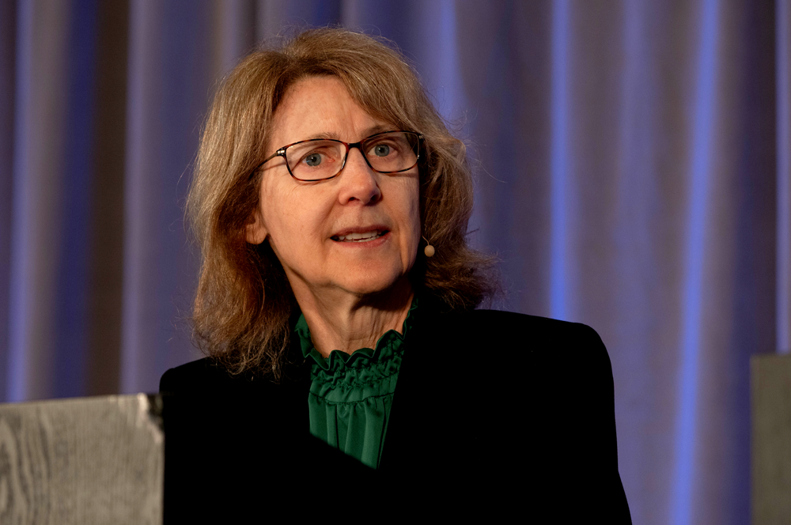
About the Enduring Program
The live meeting is being video
and audio recorded.
The proceedings from today will
be edited and developed into
an enduring web-based
program.
An email will be sent to all attendees when the activity is available.
To learn more about our education programs, visit our website, www.ResearchToPractice.com
Notes:
21
21

Slide 22

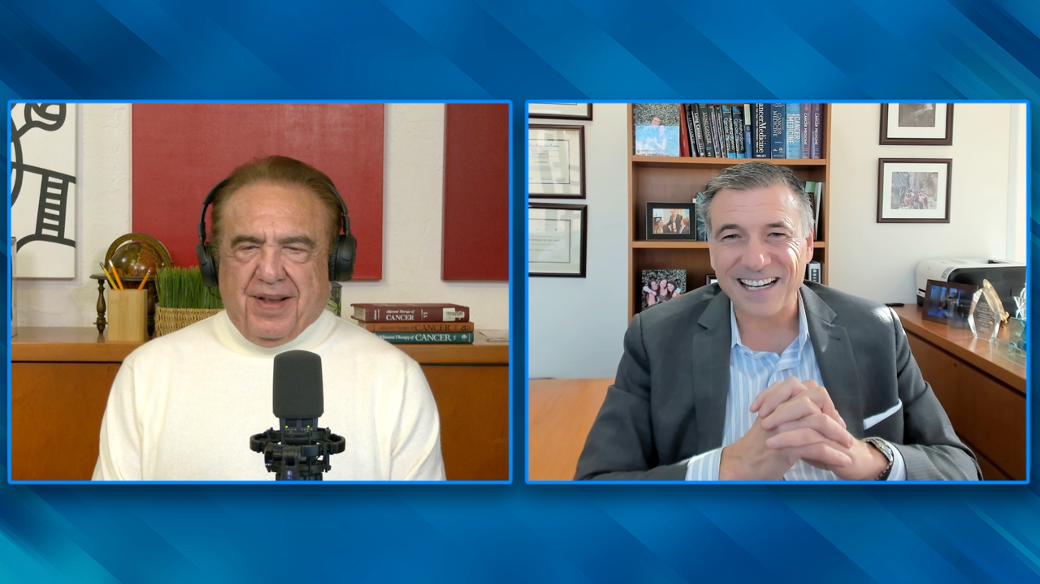
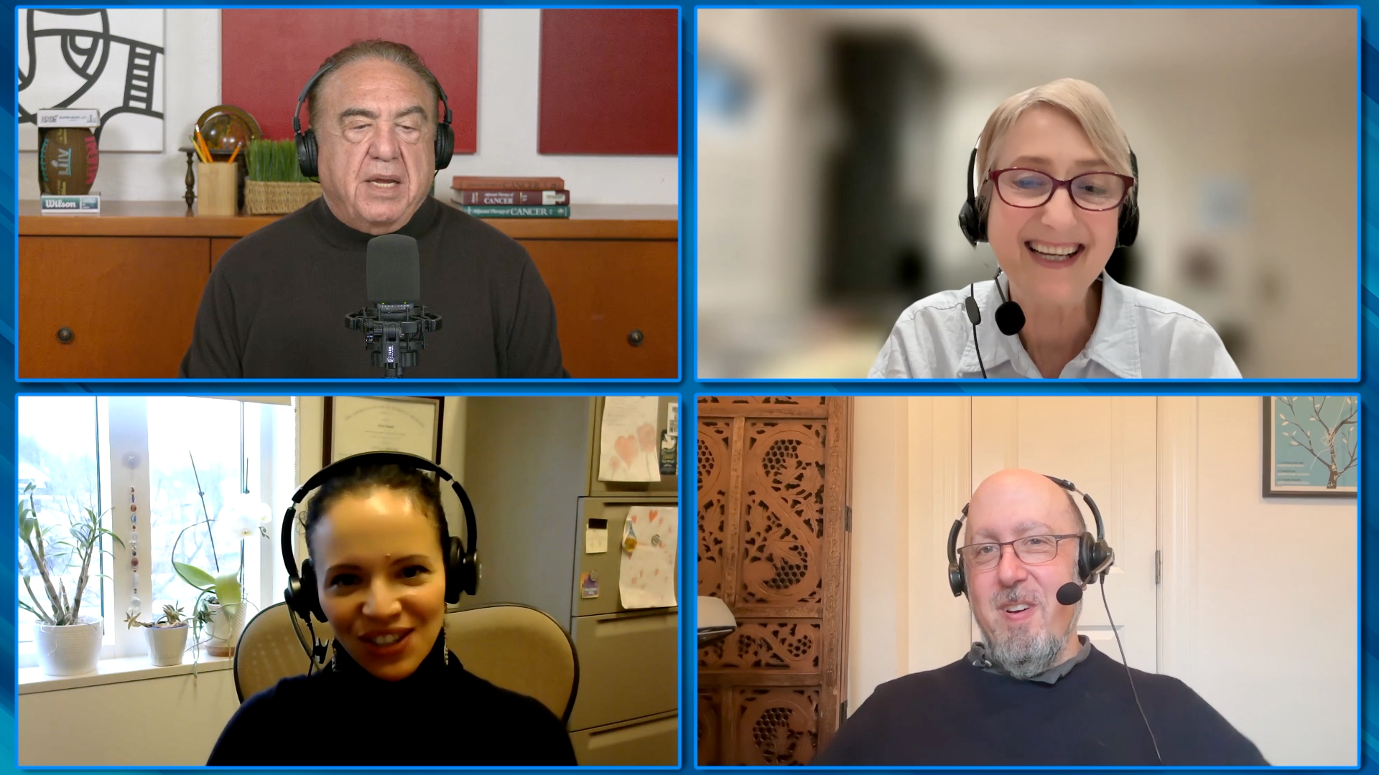
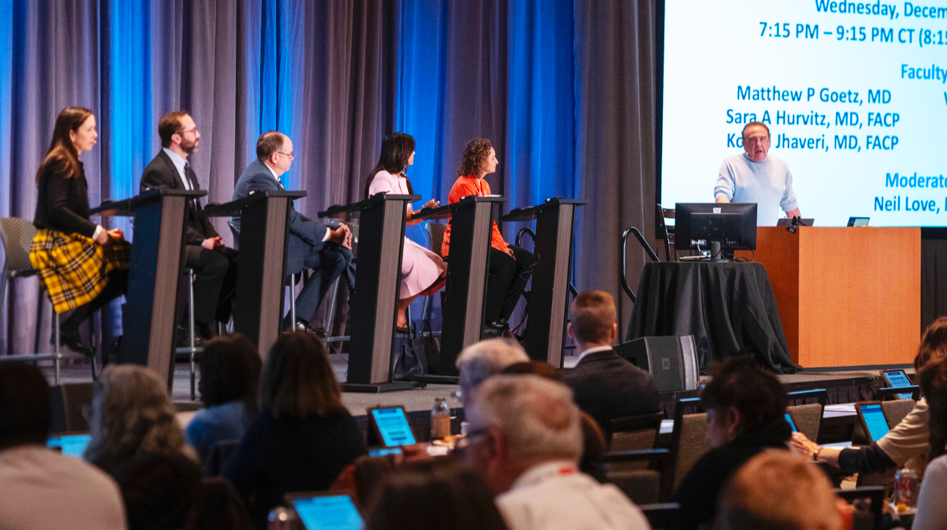
RTP Content Distribution Platform
250 Hours Annually
Interviews | Panels | Meetings
110 hours | 45 hours | 95 hours
Podcast
Website/ App
Email
Streaming Platforms
Social Media
QR Code Cards

Slide 23
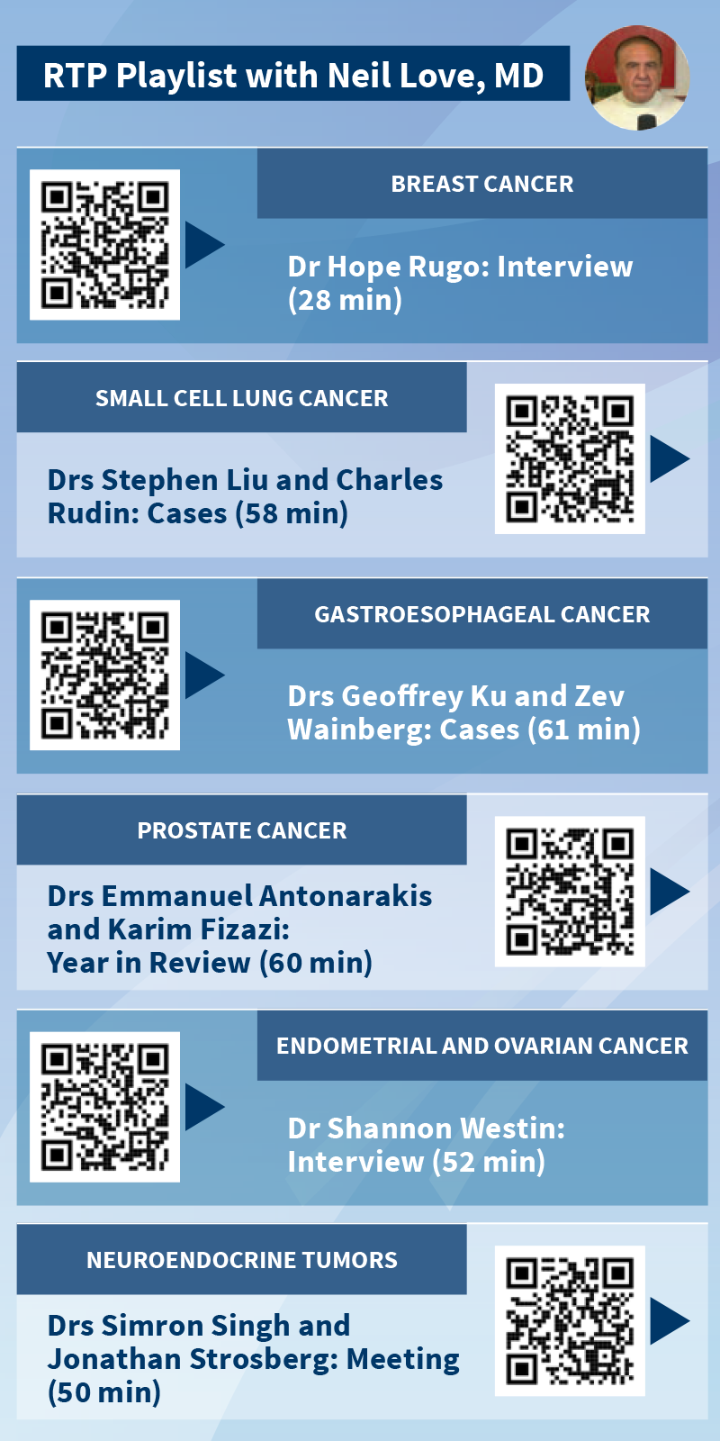
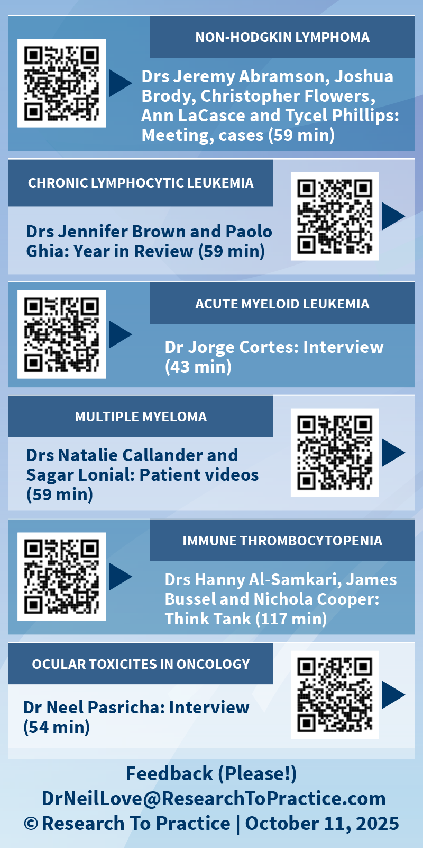

Slide 24
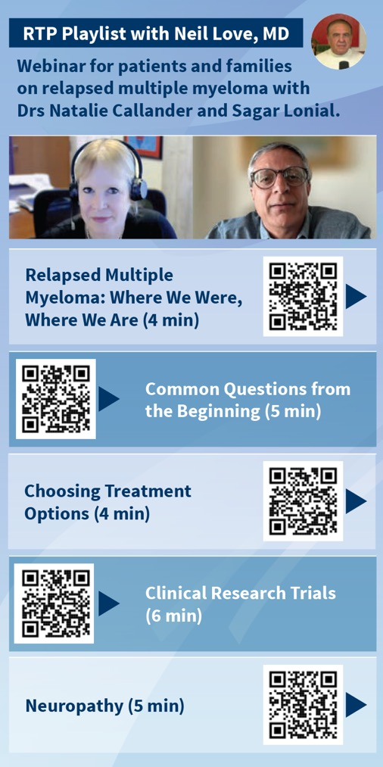
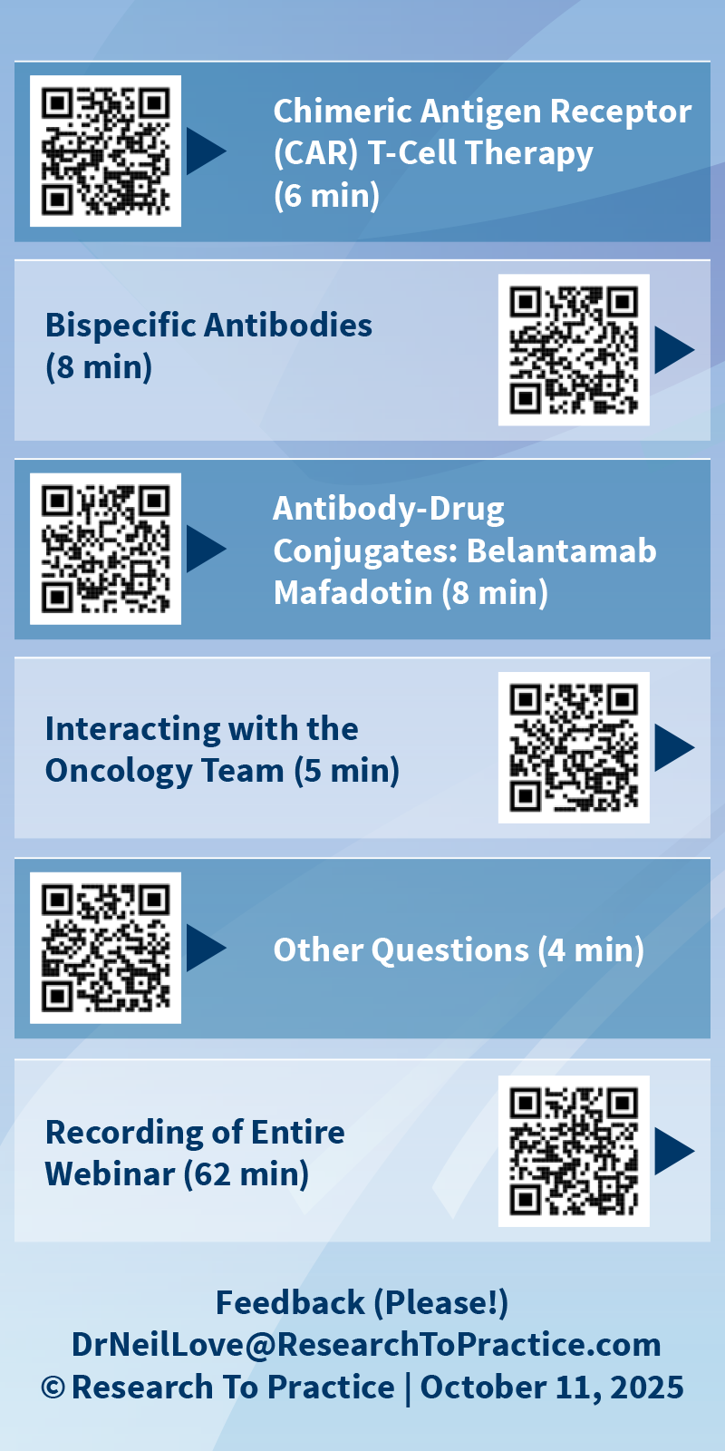

Slide 25









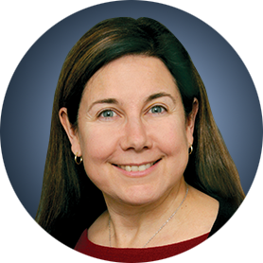
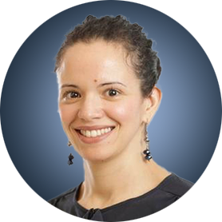




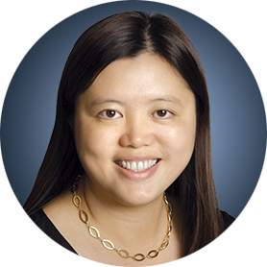
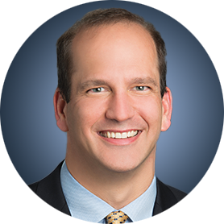


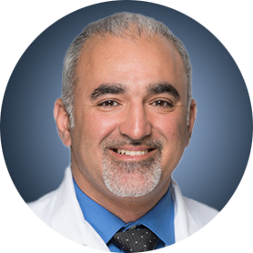

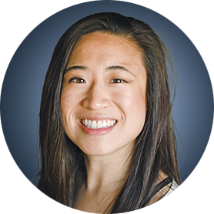





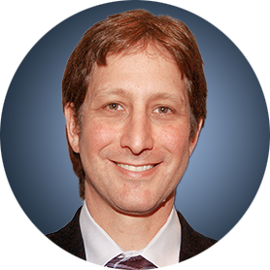


ASH and SABCS RTP Video Participants

Slide 26

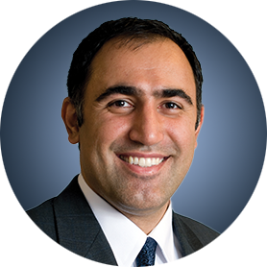
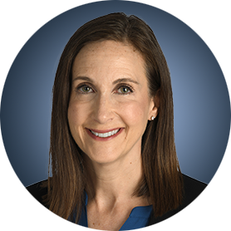



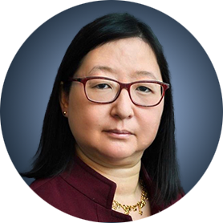
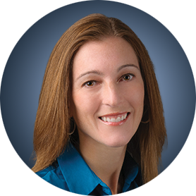

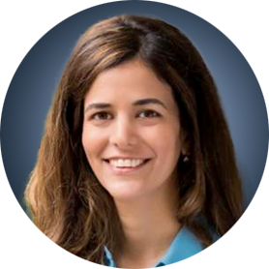





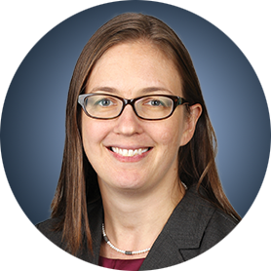




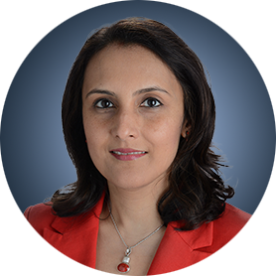





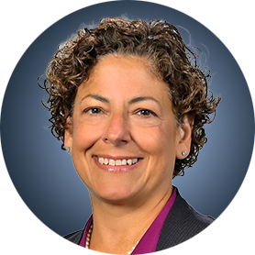

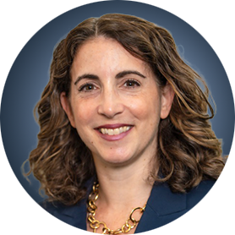
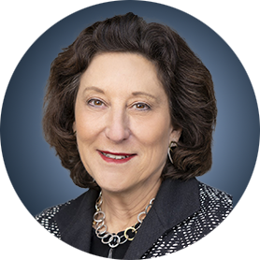

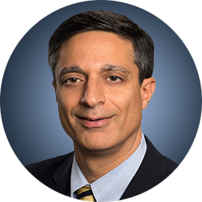



ASH and SABCS RTP Participating Faculty

Slide 27
Expert Second Opinion
Investigators Discuss the Role of Novel Treatment Approaches in the Care of Patients with Follicular Lymphoma and Diffuse Large B-Cell Lymphoma
A CME-Accredited Friday Satellite Symposium Preceding the 67th ASH Annual Meeting
Friday, December 5, 2025
7:00 PM – 9:00 PM ET
Faculty
Nancy L Bartlett, MD
John P Leonard, MD
Matthew Matasar, MD
Loretta J Nastoupil, MD
Professor Pier Luigi Zinzani
Moderator
Neil Love, MD

Slide 28
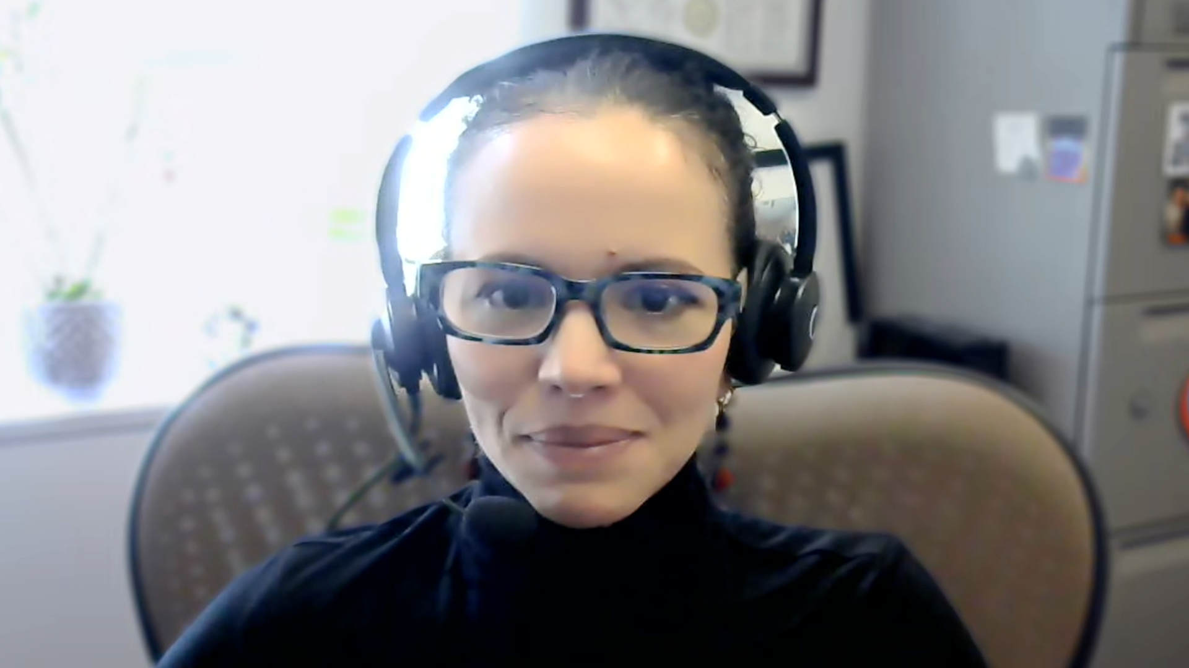
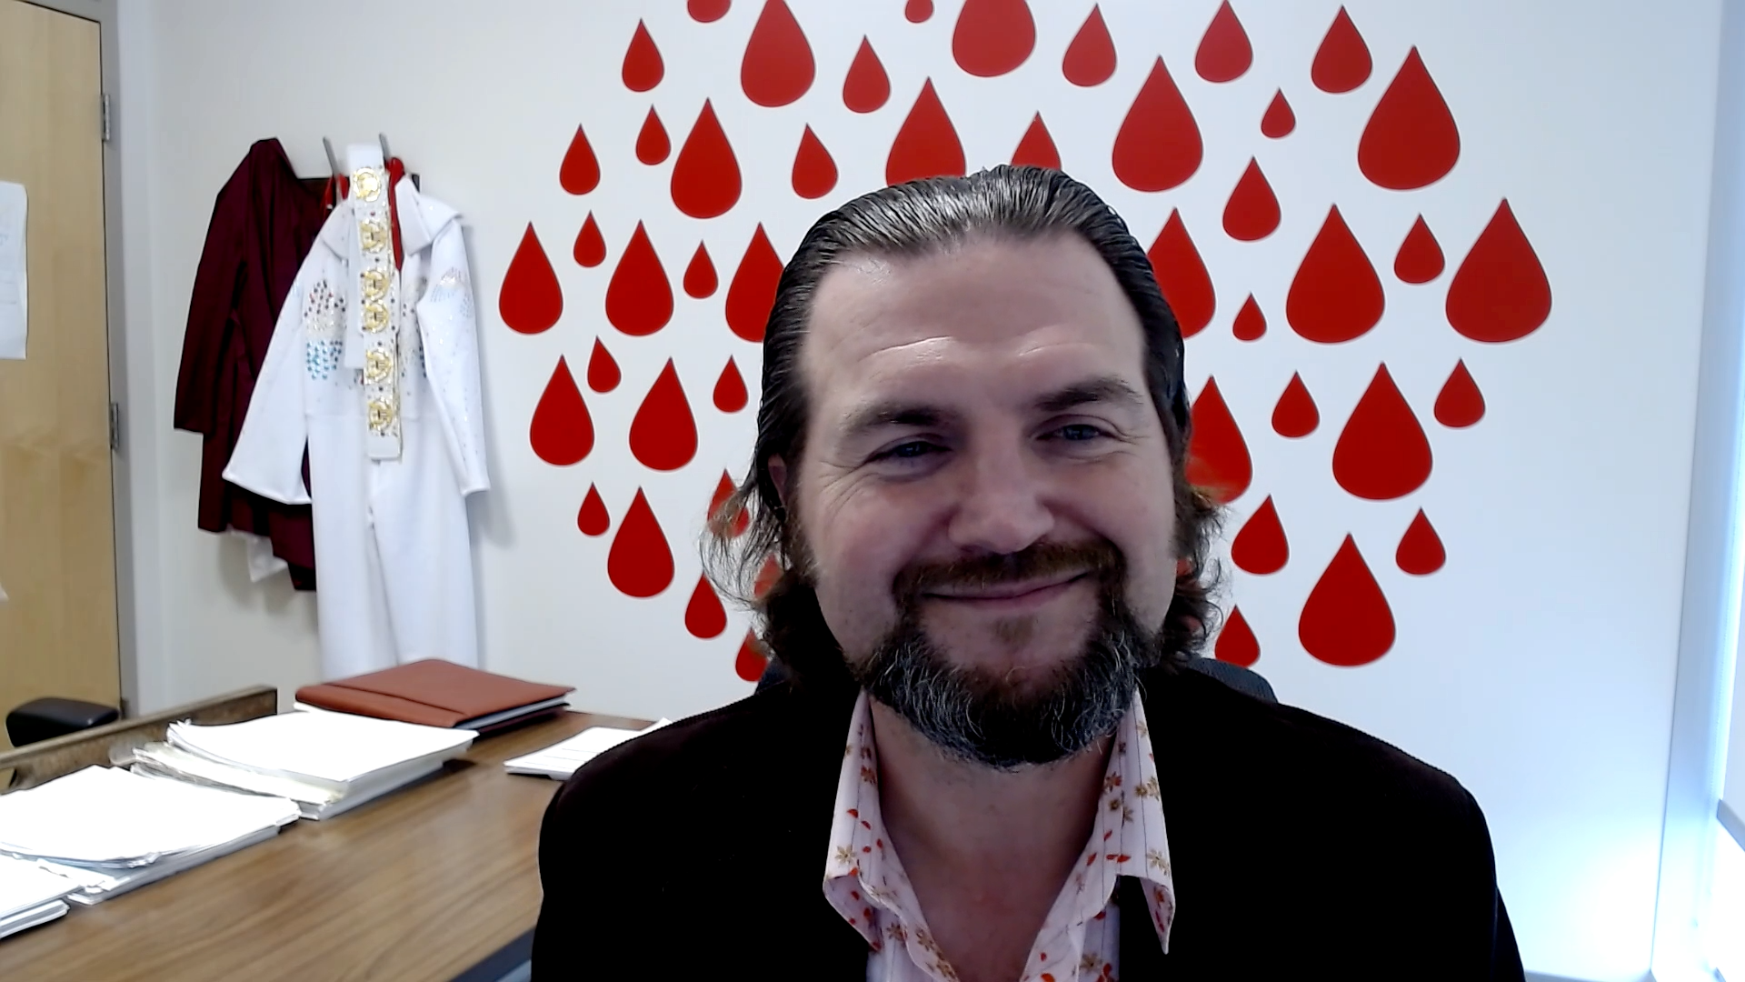
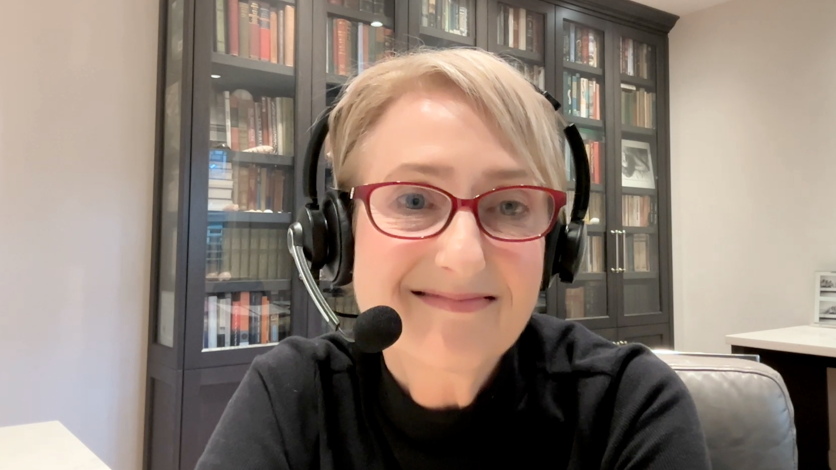
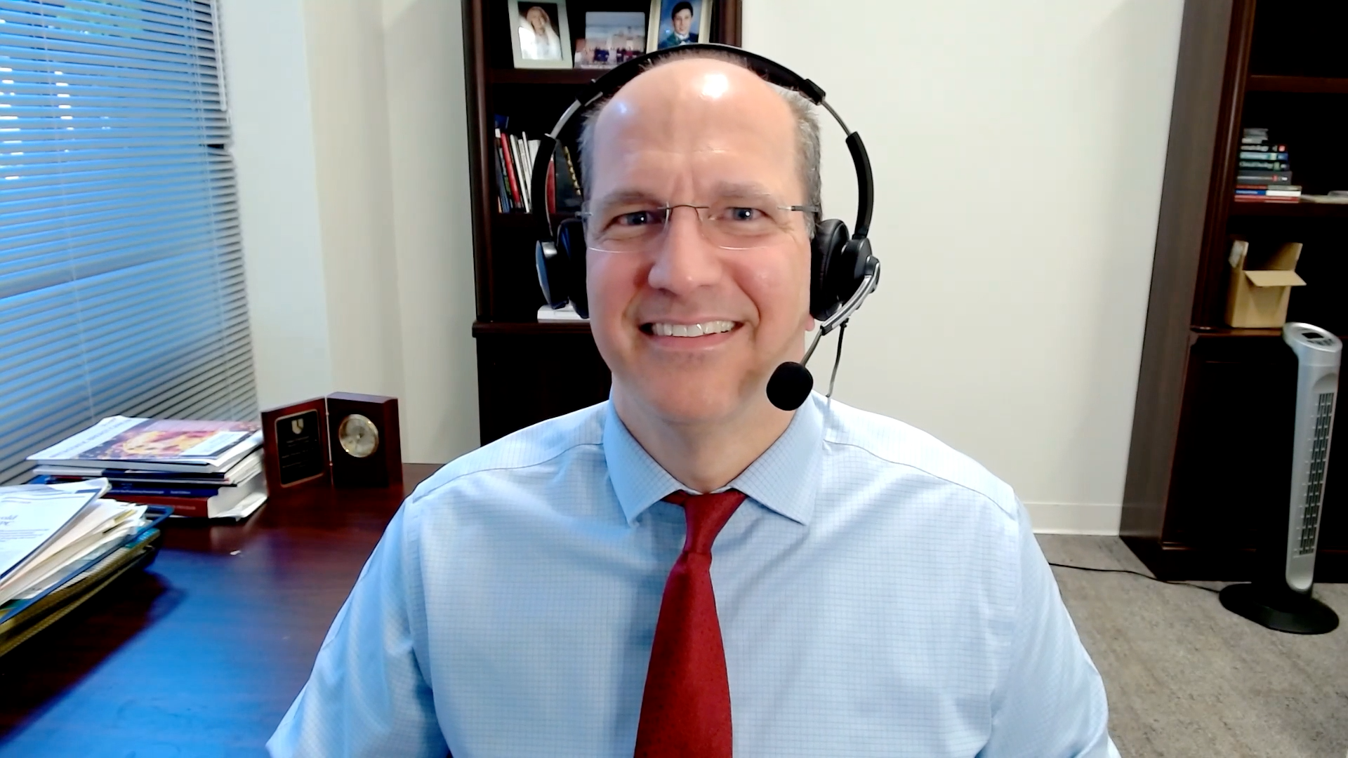
Consulting Faculty
Carla Casulo, MD
Associate Professor of Medicine
Division of Hematology/Oncology
Assistant Director, Cancer Research Training and Education
University of Rochester
Wilmot Cancer Institute
Rochester, New York
Matthew Lunning, DO
Professor
Medical Director, Gene and Cellular Therapy
Associate Vice Chair of Research, Department of Medicine
Assistant Vice Chancellor for Clinical Research
Fred and Pamela Buffett Cancer Center
University of Nebraska Medical Center
Omaha, Nebraska
Laurie H Sehn, MD, MPH
Chair, Lymphoma Tumour Group
BC Cancer Centre for Lymphoid Cancer
Clinical Professor of Medicine
The University of British Columbia
Vancouver, British Columbia, Canada

Slide 29
Agenda
Module 1: Rational Incorporation of Antibody-Drug Conjugates into the Management of Newly Diagnosed Diffuse Large B-Cell Lymphoma (DLBCL) —
Dr Matasar
Module 2: Clinical Utility of CD19-Directed Monoclonal Antibodies for DLBCL and Follicular Lymphoma (FL) — Dr Leonard
Module 3: Optimal Use of Antibody-Drug Conjugates in the Treatment of Relapsed/Refractory DLBCL — Prof Zinzani
Module 4: Bispecific Antibody Therapy for DLBCL — Dr Bartlett
Module 5: Bispecific Antibody Therapy for FL and Other Lymphoma Subtypes — Dr Nastoupil

Slide 30
Agenda
Module 1: Rational Incorporation of Antibody-Drug Conjugates into the Management of Newly Diagnosed Diffuse Large B-Cell Lymphoma (DLBCL) —
Dr Matasar
Module 2: Clinical Utility of CD19-Directed Monoclonal Antibodies for DLBCL and Follicular Lymphoma (FL) — Dr Leonard
Module 3: Optimal Use of Antibody-Drug Conjugates in the Treatment of Relapsed/Refractory DLBCL — Prof Zinzani
Module 4: Bispecific Antibody Therapy for DLBCL — Dr Bartlett
Module 5: Bispecific Antibody Therapy for FL and Other Lymphoma Subtypes — Dr Nastoupil

Slide 31
Diffuse large B-cell lymphoma:
Emerging strategies
Matt Matasar, MD
Chief of Blood Disorders, Rutgers Cancer Institute
Professor of Medicine, Rutgers RWJ Medical School

Slide 32
DLBCL: An Aggressive, Common Lymphoma
Estimated cases and distribution of mature non-Hodgkin lymphoid neoplasm subtypes in the USA in 2016
Follicular lymphoma
12%
DLBCL
27,650 (25%)
Marginal zone lymphoma
7%
Lymphoplasmacytic lymphoma* 2%
Hairy cell leukaemia 2%
Mycosis fungoides 1%
Burkitt lymphoma/leukaemia 1%
Others 1%
Total mature NHL = 112,380
Plasma cell
neoplasms
23%
Peripheral T-cell lymphoma
4%
CLL/SLL
19%
Mantle cell lymphoma
3%
*Includes Waldenstrom macroglobulinemia. †Includes hairy cell leukemia variant CLL/SLL, chronic lymphocytic leukemia/small lymphocytic lymphoma; IPI, International Prognostic Index
BTKi = Bruton’s tyrosine kinase inhibitor; DLBCL = diffuse large B-cell lymphoma; VA = Veterans Affairs; 1. Tilly H, et al. Ann Oncol. 2015;26(Suppl 5):v116-125. 2. Stewart BW, Wild CP. http://publications.iarc.fr/Non-Series-Publications/World-Cancer-Reports/World-Cancer-Report-2014/. Accessed June 14, 2019. 3. The Non-Hodgkin’s Lymphoma Classification Project. Blood. 1997;89:3909-3918. 4. Gascoyne RD, et al. WHO classification, Lyon 2017.
Notes:
Presenting faculty: This slide is animated

Slide 33

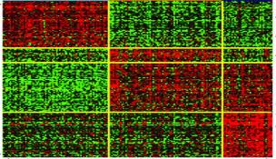
DLBCL – Not One Disease
OS in Patients With DLBCL Who Received Rituximab
1.0
ABC
GCB
PMBCL
IRF4
0.8
PIM2
Gene Expression
GCB (n = 100)
CCND2
FOXP1
IL16
High
CD44
IGHM
Genes
MME
0.6
CR2
Low
KCNN3
OS (Proportion)
LRMP
LMO2
MYBL1
SLAM
TNFSF4
CCL17
Non-GCB (n = 141)
PDL2
0.4
MAL
IL4I1
Lymphoma Biopsies
0.8
0.2
0.8
0.6
0.6
P = .0018
0.4
0.4
0
0.2
0.2
P = 8.06 x 10⁻⁶
0
1
2
3
4
5
6
7
8
9
10
11
12
0
P = 2.27 x 10⁻⁸
0
0
1
2
3
4
5
0
1
2
3
4
Year
Year
Year
GCB DLBCL
ABC DLBCL
ABC = activated B-cell DLBCL; DLBCL = diffuse large b-cell lymphoma; GCB = germinal center B-cell-like DLBCL; OS = overall survival; PMBCL = primary mediastinal large B cell lymphoma; 1. Wilson WH. Hematology Am Soc Hematol Educ Program. 2013;2013:584-590. 2. Meyer PN, et al. J Clin Oncol. 2011;29(2):200-207.

Slide 34
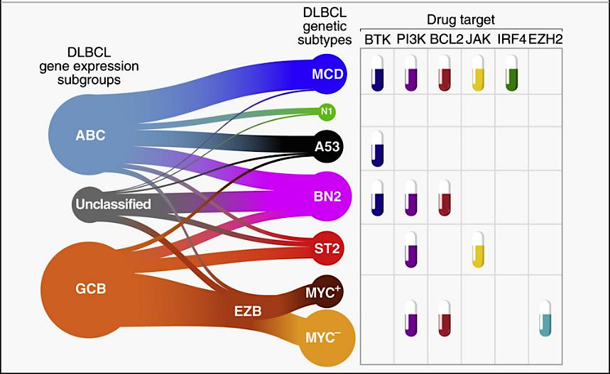
LymphGen Molecular Classification
Characteristics OS
MYD88 L265P mutations and CD79B mutations
CDKN2A deletions
40%
NOTCH1 mutations. BCOR, ikB kinase β mutations
27%
TP53 mutations/deletions
Aneuploidy
63%
NOTCH2 mutations, BLC6 translocation, TNFAIP3 (A20), BCL10, PRKCB mutations
67%
SGK1 and TET2 mutated
84%
EZH2, CREBP, KMT2D, EP300 mutations and
BCL2, MYC, TP53, GNA13, FOX01 alterations
48%
EZH2, CREBP, KMT2D, EP300 mutations and
BCL2 translocations
CARD11, TNFAIP3 (A2) alterations
82%
Wright GW. Cancer Cell. 2020;37(4):551-568.e14.

Slide 35
Evolution of Standards
Improved PFS (and OS)
CHOP¹
R-CHOP³
R-ACVBP⁷
Pola + RCHP¹⁴
1976
2002
1993
2008
2010
2011
2013
2017
2019
2021
Lenalidomide + R-CHOP
Venetoclax + R-CHOP^{12,13}
Dose-dense,
Dose-intense
chemotherapy²
R-DA-EPOCH, Ibrutinib + R-CHOP^{10,11}
O-CHOP⁹
R-CHOP 14
HDT consolidation⁸
Did not improve PFS
R-CHOEP
R-CHOP>ICE⁵
8 cycles (vs. 6 cycles)⁴
1. McKelvey EM, et al. Cancer. 1976;38(4):1484-1493. 2. Waits TM, et al. J Clin Oncol. 1993;11(5):943-949. 3. Coiffier B, et al. N Engl J Med. 2002;346(4):235-242. 4. Pfreundschuh M, et al. Lancet Oncol. 2008;9(2):105-116. 5. Moskowitz C, et al. Blood. 2010;116(21):420. 6. ??? 7. Récher C, et al. Lancet. 2011;378(9806):1858-1867. 8. Cunningham D, et al. Lancet. 2013;381(9880):1817-1826. 9. Peyrade F, et al. Lancet Hematol. 2017;4(1):e46-e55. 10. Bartlett NL, et al. J Clin Oncol. 2019;37(21). 11. Younes A, et al. J Clin Oncol. 2019;37(15):1285-1295. 12. Nowakowski GS, et al. J Clin Oncol. 2021;39(12):1317-1328. 13. Morschhauser F, et al. Blood. 2021;137(5):600-609. 14. Morschhauser F, et al. J Clin Oncol. 2025.

Slide 36
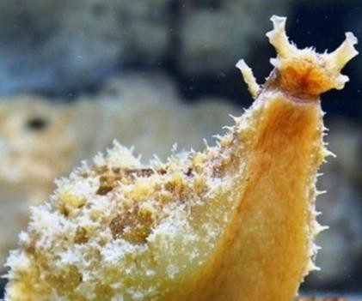
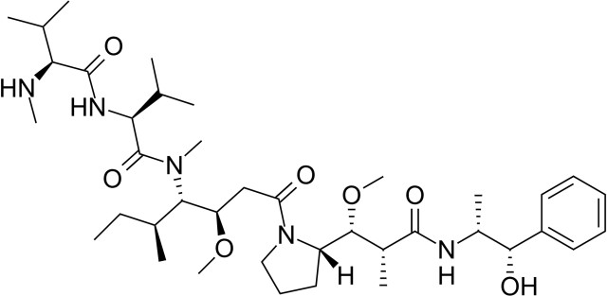
Polatuzumab VEDOTIN
Vedotin is MMAE + linker: monomethyl auristatin E
Targets CD79, part of B-cell receptor
Pan B-cell antigen and in precursors
Binds to tubulin
Cleavable linker
200x more potent than vincristine

Slide 37
POLARIX: Pola-R-CHP in Previously Untreated DLBCL
Pola-R-CHP
Polatuzumab vedotin (1.8mg/kg)*
R-CHP + vincristine placebo
Patients
Previously untreated DLBCL
Age 18–80 years
IPI 2–5
ECOG PS 0–2
Rituximab
375mg/m²
R
1:1
R-CHOP
Stratification Factors
IPI score (2 vs 3-5)
Bulky disease (<7.5 vs ≥ 7.5 cm)
Geographic region (Western Europe, US, Canada, & Australia vs Asia vs Rest of World)
R-CHOP† +
polatuzumab vedotin placebo
*IV on Day 1; †R-CHOP: IV rituximab 375mg/m², cyclophosphamide 750mg/m², doxorubicin 50mg/m², and vincristine 1.4mg/m² (max. 2mg) on Day 1, plus oral prednisone 100mg once daily on Days 1–5. ECOG PS = Eastern Cooperative Oncology Group performance status; IPI = International prognostic index; R = randomized. Tilly H, et al. N Engl J Med. 2022;386:351-363.

Slide 38
POLARIX: Pola-R-CHP in Previously Untreated DLBCL
Primary Endpoint: Progression-Free Survival
Pola-R-CHP significantly improved PFS versus R-CHOP
Pola-R-CHP demonstrated a 27% reduction in the relative risk of disease progression, relapse, or death versus R-CHOP
24-month-PFS:
  76.7% with Pola-R-CHP
  70.2% with R-CHOP (∆=6.5%)
Most common adverse events from Pola-R-CHP, R-CHOP consisted of peripheral neuropathy, nausea, neutropenia, diarrhea, anemia, constipation
100
80
60
R-CHOP (n=439)
PFS (%)
40
 | Pola-R-CHP (n = 440) | R-CHOP (n = 439)
Events (%) | 107 (24.3) | 134 (30.5)
2-Year PFS % | 76.7 | 70.2
HR (95% CI) | 0.73 (0.57, 0.95)
2-sided P value | 0.02
Pola-R-CHP (n=440)
20
0
0
6
12
18
24
30
36
42
No. at risk
Months
Pola-R-CHP
R-CHOP
440
439
404
389
353
330
327
296
246
220
78
78
NE
3
NE
NE
CI = confidence interval; HR = hazard ratio; PFS = progression-free survival; Pola-R-CHP = polatuzumab vedotin, rituximab, cyclophosphamide, doxorubicin, prednisone; R-CHOP = rituximab, cyclophosphamide, doxorubicin hydrochloride, vincristine, prednisone. Tilly H, et al. N Engl J Med. 2022;386:351-363.

Slide 39
POLARIX: Pola-R-CHP in Previously Untreated DLBCL
Overall Survival
100
Pola-R-CHP (N=440)
80
R-CHOP (N=439)
60
OS (%)
 | Pola-R-CHP (n = 440) | R-CHOP (n = 439)
Patients who died – no. (%) | 53 (12.0) | 57 (13.0)
Estimated 2-Year OS months, (95% CI) | 88.7 (85.7-91.6) | 88.6 (85.6-91.6)
HR (95% CI) | 0.94 (0.65-1.37)
2-sided P value | 0.75
40
20
0
0
6
12
18
24
30
36
42
No. at risk
Months
Pola-R-CHP
R-CHOP
440
439
423
414
397
401
384
376
362
355
140
132
15
20
1
1
CI = confidence interval; HR = hazard ratio; No. = number; OS = overall survival; Pola-R-CHP = polatuzumab vedotin, rituximab, cyclophosphamide, doxorubicin, prednisone; R-CHOP = rituximab, cyclophosphamide, doxorubicin hydrochloride, vincristine, prednisone. Tilly H, et al. N Engl J Med. 2022;386:351-363.

Slide 40
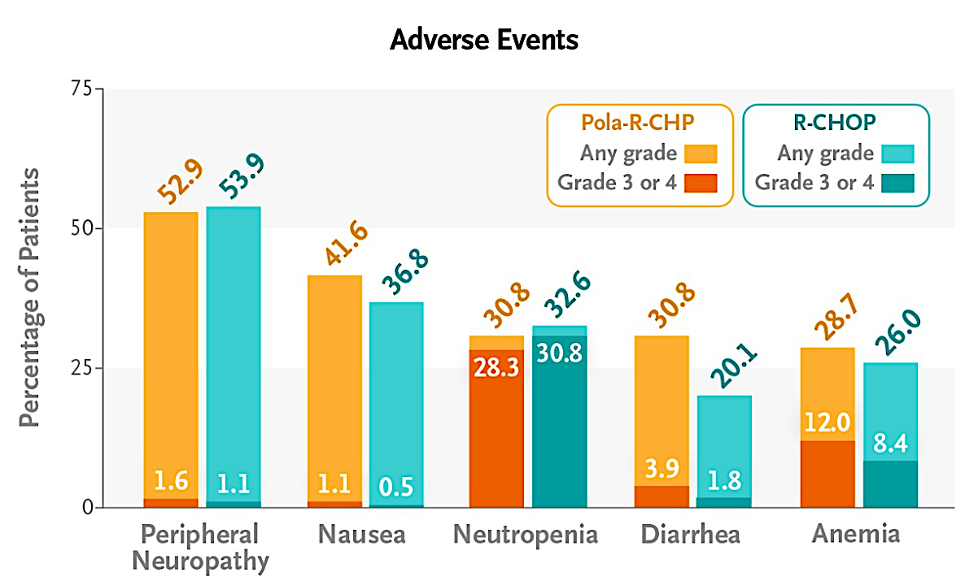
Polatuzumab vedotin in combination:
Safety Profile
POLARIX Study G029365 Phase 1b/2
“PBR”
AE, n (%)ª | Pola-BR (n=39) | BR (n=39) |  | Pola-BR (n=39) | BR (n=39)
 | All Grade | All Grade |  | Grade 3-4 | Grade 3-4
Blood and lymphatic system disorders
Anemia | 21 (54) | 10 (26) |  | 11 (28) | 7 (18)
Neutropenia | 21 (54) | 15 (39) |  | 18 (46) | 13 (33)
Thrombocytopenia | 19 (49) | 11 (28) |  | 16 (41) | 9 (23)
GI disorders
Diarrhea | 15 (39) | 11 (28) |  | 1 (3) | 1 (3)
Nausea | 12 (31) | 16 (41) |  | 0 | 0
Constipation | 7 (18) | 8 (21) |  | 0 | 1 (3)
General disorders and administration site conditions
Fatigue | 14 (36) | 14 (36) |  | 1 (3) | 1 (3)
Pyrexia | 13 (33) | 9 (23) |  | 1 (3) | 0
Metabolism and nutrition disorders
Decreased appetite | 10 (26) | 8 (21) |  | 1 (3) | 0
Peripheral neuropathy
Peripheral neuropathy^{b} | 17 (44) | 3 (8) |  | 0 | 0
Tilly H et al, NEJM, 2022; Sehn L et al, JCO, 2020

Slide 41
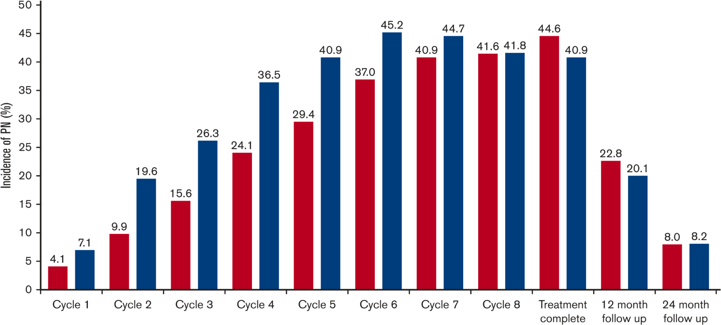
Polatuzumab: Peripheral Neuropathy
Pola-RCHP
40 – 50% of patients will develop some peripheral neuropathy
Predominantly sensory
Many reversible
Severe cases can have motor impairment
About 4 months to resolution
0.7% drug d/c
4% dose reduction
Pola-R-CHP
R-CHOP
BEST PRACTICES IN
DIFFUSE LARGE B-CELL LYMPHOMA
Trneny et al, Blood Advances 2025

Slide 42
POLARIX: Subgroup Analysis
 |  | Pola-R-CHP (N = 440) |  |  | R=CHOP (N = 439)
Baseline Risk Factors | Total N | n | 2-yr Rate |  | n | 2-yr Rate | HR | 95% Wald CI
Age group
≤60 | 271 | 140 | 74.1 |  | 131 | 71.9 | 0.9 | (0.6-1.5)
>60 | 608 | 300 | 77.9 |  | 308 | 69.5 | 0.7 | (0.5-0.9)
Sex
Male | 473 | 239 | 75.9 |  | 234 | 65.9 | 0.7 | (0.5-0.9)
Female | 406 | 201 | 77.7 |  | 205 | 75.2 | 0.9 | (0.6-1.4)
ECOG PS
0-1 | 737 | 374 | 78.4 |  | 363 | 71.2 | 0.8 | (0.6-1.0)
2 | 141 | 66 | 67.2 |  | 75 | 65.0 | 0.8 | (0.5-1.4)
IPI score
IPI 2 | 334 | 167 | 79.3 |  | 167 | 78.5 | 1.0 | (0.6-1.0)
IPI 3-5 | 545 | 273 | 75.2 |  | 272 | 65.1 | 0.7 | (0.5-1.4)
Bulky disease
Absent | 494 | 247 | 82.7 |  | 247 | 70.7 | 0.6 | (0.4-0.8)
Present | 385 | 193 | 69.0 |  | 192 | 69.7 | 1.0 | (0.7-1.5)
Geographic region
Western Europe, US, Canada, and Australia | 603 | 302 | 78.6 |  | 301 | 72.0 | 0.8 | (0.6-1.1)
Asia | 160 | 81 | 74.3 |  | 79 | 65.6 | 0.6 | (0.4-1.5)
Rest of world | 116 | 57 | 70.8 |  | 59 | 67.3 | 0.9 | (0.6-1.5)
Ann Arbor stage
I-II | 99 | 47 | 89.1 |  | 52 | 85.5 | 0.6 | (0.2-1.8)
III | 232 | 124 | 80.7 |  | 108 | 73.6 | 0.8 | (0.5-1.3)
IV | 548 | 269 | 72.6 |  | 279 | 66.1 | 0.8 | (0.6-1.1)
Baseline LDH
≤ULN | 300 | 146 | 78.9 |  | 154 | 75.6 | 0.8 | (0.5-1.3)
>ULN | 575 | 291 | 75.4 |  | 284 | 67.2 | 0.7 | (0.5-1.0)
No. of extranodal sites
0-1 | 453 | 227 | 80.2 |  | 226 | 74.5 | 0.8 | (0.5-1.1)
≥2 | 426 | 213 | 73.0 |  | 213 | 65.8 | 0.7 | (0.5-1.0)
Cell-of-origin
GCB | 352 | 184 | 75.1 |  | 168 | 76.9 | 1.0 | (0.7–1.5)
ABC | 221 | 102 | 83.9 |  | 119 | 58.8 | 0.4 | (0.2-0.6)
Unclassified | 95 | 44 | 73.0 |  | 51 | 86.2 | 1.9 | (0.8-4.5)
Unknown | 211 | 110 | 73.8 |  | 101 | 64.3 | 0.7 | (0.4-1.2)
Double expressor by IHC
DEL | 290 | 139 | 75.5 |  | 151 | 63.1 | .63 | (0.4-1.0)
Non DEL | 438 | 223 | 77.7 |  | 215 | 75.7 | 0.9 | (0.6-1.3)
Unknown | 151 | 78 | 76.0 |  | 73 | 69.8 | 0.8 | (0.4-1.5)
Double- or triple-hit lymphoma
Yes | 45 | 26 | 69.0 |  | 19 | 88.9 | 3.8 | (0.8-17.6)
No | 620 | 305 | 76.8 |  | 315 | 70.3 | 0.7 | (0.5-1.0
Unknown | 214 | 109 | 78.5 |  | 105 | 66.4 | 0.6 | (0.4-1.1)
Pola-R-CHP
better
R-CHOP
better
Pola-R-CHP = polatuzumab vedotin, rituximab, cyclophosphamide, doxorubicin, prednisone; R-CHOP = rituximab, cyclophosphamide, doxorubicin hydrochloride, vincristine, prednisone. Tilly H, et al. N Engl J Med. 2022;386:351-363.

Slide 43
Cell of Origin and Polatuzumab
Cell of Origin and Response to Polatuzumab Vedotin in DLBCL
Cell of Origin and Response to Polatuzumab Vedotin Combined with Rituximab
Type
Sites
GCB
ABC
Not available
Unclassified
Pfeifer et al.
(2015)
Phase 1
US/CA/EU
P = 0.002
Segman et al.
(2019)
PostMktg
Israel
100
Morschhauser et al.
(2019)
Phase 2
US/CA/EU
Tsai et al.
(2020)
50
PostMktg
Taiwan
Terui et al.
(2021)
Maximum percent change from baseline
Phase 2
Japan
0
Combined Trials
P < 0.001
-50
Probability Density
-100
GCB
ABC
0
25
50
75
100
Morschhauser et al. (2019)
Percentage of Patients with a Response
ABC, activated B-cell-like DLBCL; CA, Canada; DLBCL, diffuse large B-cell lymphoma; EU, European Union; GCB, germinal center B-cell-like DLBCL; PostMktg, Post-Marketing.
1. Palmer AC, et al. N Engl J Med. 2023;389(8):764-766.

Slide 44
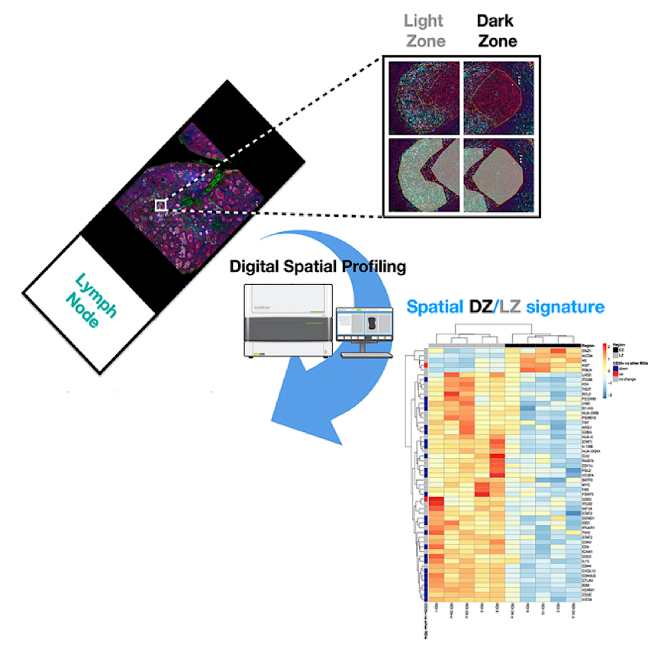
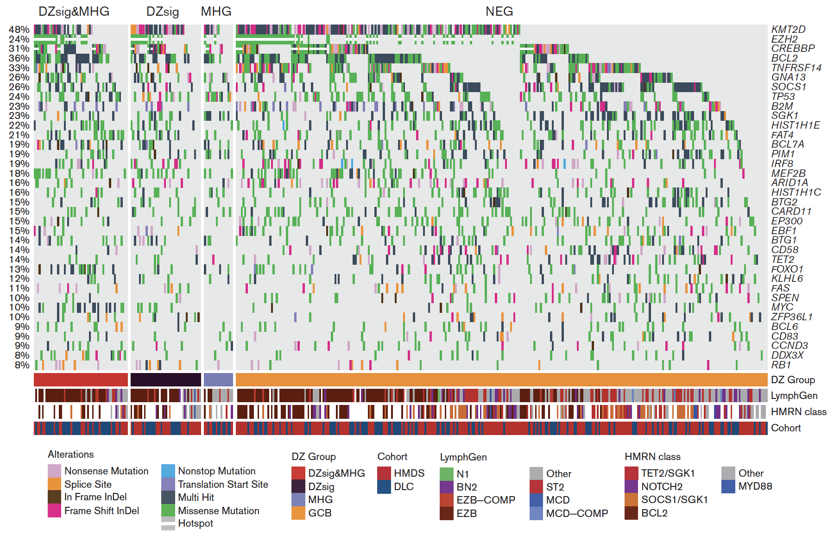
Germinal Center / EZH is not “One” Disease
DLC
HMDS
REMoDL-B
MHG
DZsig
MHG
DZsig
MHG
DZsig
9
(5.2%)
54
(19.5%)
18
(9.3%)
11
(2.2%)
53
(10.8%)
43
(8.8%)
12
(2.2%)
83
(11.6%)
51
(9.4%)
113
(65.7%)
394
(78.6%)
417
(76.5%)
1. Tripodo C, et al. iScience. 2020;23(10):101562. 2. Davies, et al. Blood Adv. 2023 Oct 24;7(20):6156-6162.

Slide 45
POLARIX: Benefit in “Dark Zone Signature” GCB/EZB
 | Pola-R-CHP DZsig+ | Pola-R-CHP DZsig- | R-CHOP DZsig+ | R-CHOP DZsig-
2-yr PFS (95% CI) | 79% (74-84) | 77% (66-89) | 62% (51-77) | 73% (68-79)
HR (95% CI) | 0.97 (0.54-1.75) |  | 1.61 (1.02-2.56)
1.00
0.75
Pola-R-CHP: DZsig+
Pola-R-CHP: DZsig-
R-CHOP: DZsig-
0.50
R-CHOP: DZsig+
PFS (probability)
0.25
0.00
0
6
12
18
24
30
36
42
48
No. at risk
Months
Pola-R-CHP: DZsig+
Pola-R-CHP: DZsig-
R-CHOP: DZsig+
R-CHOP: DZsig-
52
279
56
278
48
259
45
258
42
231
37
221
40
215
32
201
37
203
31
191
31
152
18
155
10
70
11
62
9
42
10
39
0
0
0
2
CI = confidence interval; HR = hazard ratio; PFS = progression-free survival; Morschhauser F, et al. Blood. 2023;142(Suppl 1):3000.

Slide 46
POLAR BEAR:
Study Design
Pola+R-mini-CHOP in Elderly DLBCL
Arm A:
R-mini-CHOP
Pola Placebo
Q21D x 6 Cycles
Patient Population:
Previously untreated DLBCL
≥ 80 years, or frail ≥ 75 years
ECOG PS 0-3
N = 200
R
1:1
Arm B:
Pola 1.8 mg/kg
R-mini-CHP + vincristine placebo
Q21D x 6 Cycles
Primary endpoint: PFS
DLBCL = diffuse large B-cell lymphoma; ECOG PS = Eastern Cooperative Oncology Group performance status; PFS = progression-free survival; Pola = polatuzumab vedotin; Q21D = every 21 days; R = randomized; R-mini-CHP = rituximab, cyclophosphamide, doxorubicin, prednisone; R-mini-CHOP = rituximab, cyclophosphamide, doxorubicin, vincristine, prednisone; Jerkeman M, et al. Hemasphere. 2023;7(Suppl):e91359ec.

Slide 47
POLAR BEAR:
No Increased Toxicity Signal
No difference in terms of grade 3-4 hematological toxicity between treatment groups
Gastrointestinal toxicity > grade 1 occurred twice as frequently in the R-pola-miniCHP polatuzumab group than in recipients of standard R-miniCHP
Relevant clinical consideration for select patients
Anemia
Grade 1
Neutropenia
Grade 2
Thrombocytopenia
Grade 3
Other hematological toxicity
Infection
Grade 4
Gastrointestinal tract
Grade 5
Cardiovascular
Unknown grade
Respiratory
Renal
Liver/Hepatic
Rash
Other skin
Osteoarticular/Muscular
Central nervous system
Peripheral nervous system
Behavioral
Other
Unknown organ
80
60
40
20
0
20
40
60
80
R-mini-CHOP
Pola-R-mini-CHP
Pola-R-mini-CHP = polatuzumab vedotin, rituximab, cyclophosphamide, doxorubicin, prednisone; R-mini-CHOP = rituximab, cyclophosphamide, doxorubicin, vincristine, prednisone; Jerkeman M, et al. Hemasphere. 2023;7(Suppl):e91359ec.

Slide 48
Polatuzumab in 1L DLBCL: Bottom line
POLARIX establishes Pola-R-CHP as a standard of care (but not the standard of care) in IPI 2+ DLBCL, PFS benefit without markedly increased toxicity
Residual uncertainty regarding subset-based or biology-based patient selection for Pola-R-CHP (vs. R-CHOP)
Data on the ability of Pola to improve outcomes in older and frailer patients are emerging
How best to continue to incorporate Pola in the context of an evolving 1L treatment landscape needs to be defined

Slide 49
Case Presentation: 58-year-old man who presents with left testicular swelling and abdominal discomfort is diagnosed with ABC-subtype Stage IV DLBCL
Dr Laurie Sehn (Vancouver, British Columbia)

Slide 50
Discussion Questions
How would you have managed care for this patient? Should he receive radiation therapy to the contralateral testis?
Would you have recommended CNS prophylaxis (if so, what type)?
Do you actively assess cell of origin in all your patients with DLBCL? Do you consider cell-of-origin testing when deciding on first-line treatment, and if so, are you comfortable with IHC testing using the Hans algorithm?

Slide 51
Discussion Questions
Would you ever attempt to rechallenge with polatuzumab vedotin later in the treatment course for a patient who received it up front and experienced subsequent disease progression?

Slide 52
Agenda
Module 1: Rational Incorporation of Antibody-Drug Conjugates into the Management of Newly Diagnosed Diffuse Large B-Cell Lymphoma (DLBCL) —
Dr Matasar
Module 2: Clinical Utility of CD19-Directed Monoclonal Antibodies for DLBCL and Follicular Lymphoma (FL) — Dr Leonard
Module 3: Optimal Use of Antibody-Drug Conjugates in the Treatment of Relapsed/Refractory DLBCL — Prof Zinzani
Module 4: Bispecific Antibody Therapy for DLBCL — Dr Bartlett
Module 5: Bispecific Antibody Therapy for FL and Other Lymphoma Subtypes — Dr Nastoupil

Slide 53

Clinical Utility of CD19-Directed Monoclonal Antibodies for DLBCL and Follicular Lymphoma (FL)
John P. Leonard, M.D.
Laura and Isaac Perlmutter Professor of Hematology and Medical Oncology
Director, Division of Hematology and Medical Oncology
Director, Center for Blood Cancers
Senior Advisor to the Dean/CEO for Enterprise Cancer Strategy and Operations
Interim Director, Perlmutter Cancer Center

Slide 54
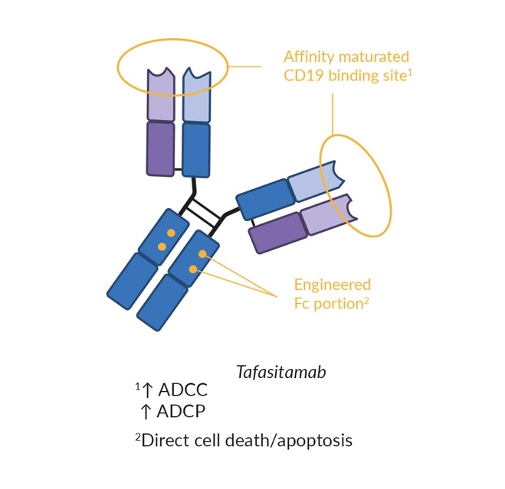
CD19 mAb: Tafasitamab
Humanized CD19-targeting monoclonal antibody (mAb)
Induces direct cytotoxicity and enhances NK cell and macrophage immune-mediated mechanisms
Meisel A, et al. Healthbook Times Oncol Hematol. 2025;23(1):151-158.

Slide 55
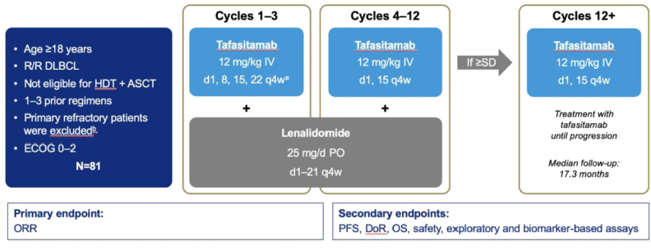
L-MIND treatment regimen for patients with recurrent DLBCL
Cheson et al, Blood Cancer J 2021

Slide 56
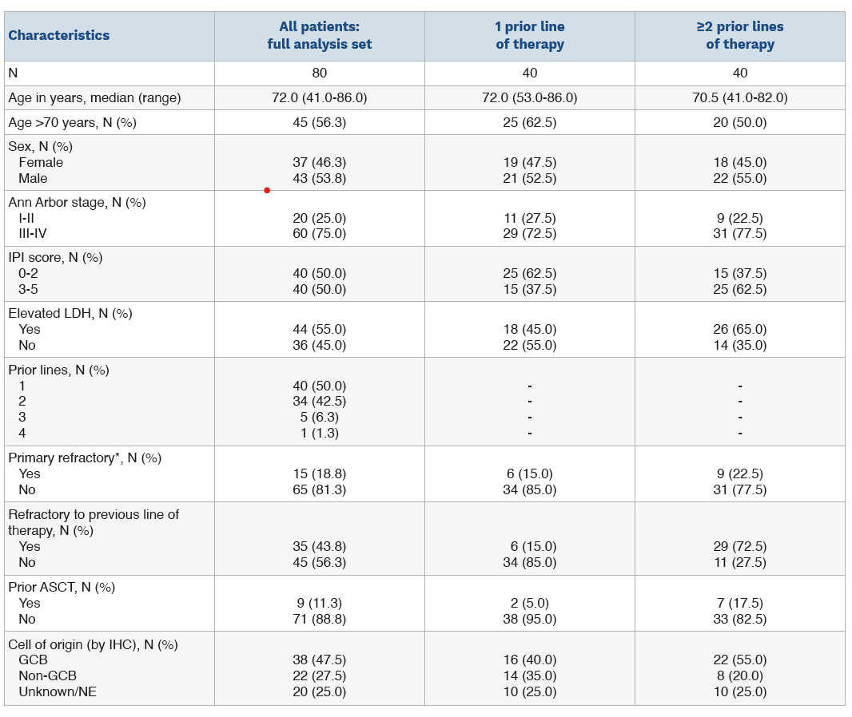
L-MIND patient characteristics
Median age 73
50% IPI 3-5
50% 1 prior rx
43% refractory
to last rx
Duell et al,
Haematologica 2024

Slide 57
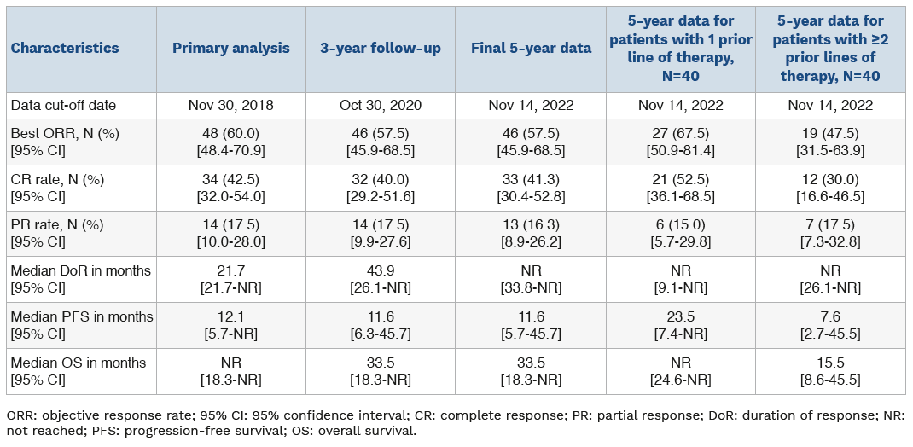
L-MIND efficacy – 5 year update
ORR 57%, CR 41%, Median PFS 11.6 m
Duell et al,
Haematologica 2024

Slide 58
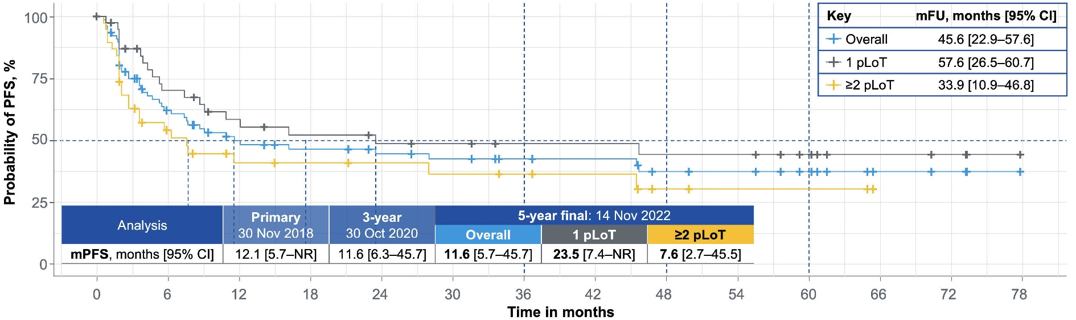
L-MIND efficacy – PFS – 5 year update
Duell et al,
Haematologica 2024

Slide 59
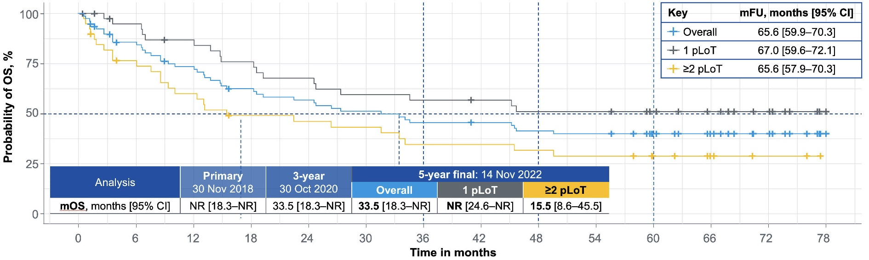
L-MIND efficacy – OS – 5 year update
Duell et al,
Haematologica 2024

Slide 60
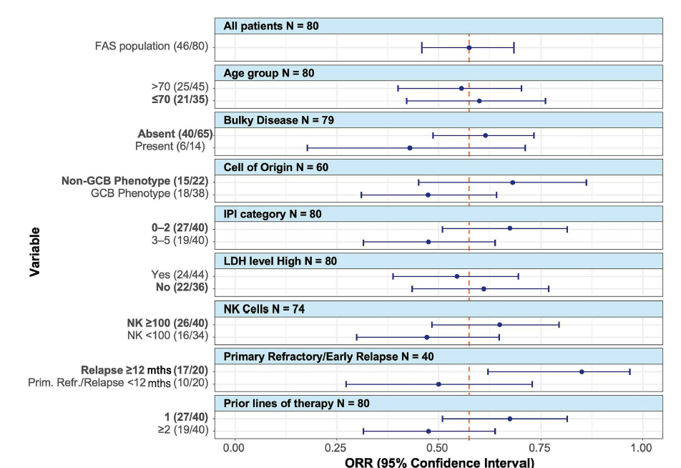
L-MIND efficacy – subgroups
Duell et al,
Haematologica 2024

Slide 61
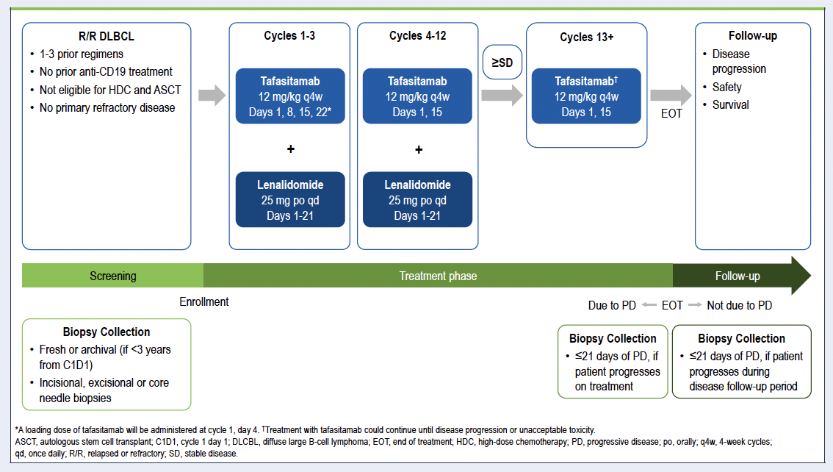
Phase 3 Study of Tafasitamab Plus Lenalidomide in Patients With Relapsed or Refractory Diffuse Large B-Cell Lymphoma (firmMIND)
N=81
Primary
Endpoint ORR
Arias DA et al. EHA 2024;Abstract P1234

Slide 62
MINDway: Ph Ib/II dose optimization study (safety and PK) of tafasitamab + lenalidomide in pts with relapsed/refractory DLBCL
Cohort 2*
Tafa 30 mg/kg + LEN 25 mg
(N=6)
Expansion Cohort*
Tafa 30 mg/kg + LEN 25 mg
(N=39)
R/R DLBCL patients:
Target accrual:
N= up to 51
Screening
Cohort 1*
Tafa 24 mg/kg
+ LEN 25 mg
(N=6)
End of Treatment
End of Study/ 90 Day safety follow-up
OR
Expansion Cohort *
Tafa 24 mg/kg + LEN 25 mg (N=39)
* In the first 28-day cycle (Cycle 1) tafasitamab is given on Day 1, Day 4 and Day 8 at a dose of 12 mg/kg
Data and Safety Monitoring Committee Meeting
Goal to reduce infusion frequency from biweekly to monthly
Greil et al EHA 2022

Slide 63
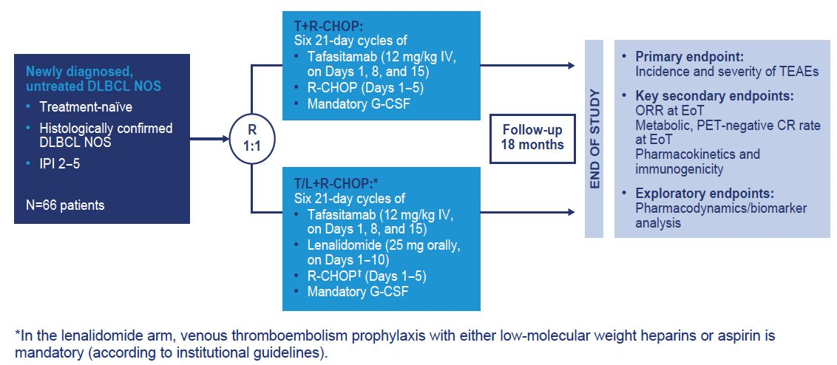
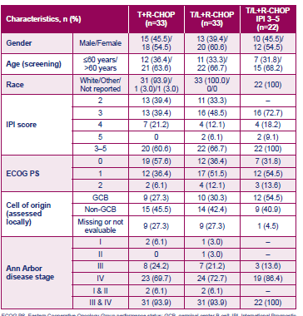
Tafasitamab +/- lenalidomide first-line + R-CHOP for DLBCL
Phase Ib First-MIND study
Most IPI 2-3
63% over age 60
Nowakowski GS et al. ASH 2022;Abstract 1619

Slide 64

Tafasitamab +/- lenalidomide first-line + R-CHOP for DLBCL
Phase Ib First-MIND study
Most common AE neutropenia, febrile neutropenia in 18%+
Nowakowski GS et al. ASH 2022;Abstract 1619

Slide 65
Tafasitamab +/- lenalidomide first-line + R-CHOP for DLBCL
Phase Ib First-MIND study
Most common
non-heme AE
Under 10% pts
Nowakowski GS et al. ASH 2022;Abstract 1619

Slide 66


Tafasitamab +/- lenalidomide first-line + R-CHOP for DLBCL
Phase Ib First-MIND study
ORR 75%-81%
24 mo PFS 72%-75%
Nowakowski GS et al. ASH 2022;Abstract 1619

Slide 67


frontMIND: Phase 3 randomized study of R-CHOP +/- Tafasitamab + lenalidomide first-line + R-CHOP for DLBCL IPI 3-5
Vitolo U et al. ASCO 2022;Abstract TPS7590

Slide 68

inMIND Phase 3 Study: Lenalidomide + Rituximab +/- Tafasitamab in pts with recurrent FL
Sehn LH, et al. Blood. 2024;144(Suppl 2):LBA-1

Slide 69

inMIND Phase 3 Study: Lenalidomide + Rituximab +/- Tafasitamab in pts with recurrent FL
Sehn LH, et al. Blood. 2024;144(Suppl 2):LBA-1

Slide 70

inMIND Phase 3 Study: Lenalidomide + Rituximab +/- Tafasitamab in pts with recurrent FL
55% 1 prior rx, 31% POD24
Sehn LH, et al. Blood. 2024;144(Suppl 2):LBA-1

Slide 71

inMIND Phase 3 Study: Lenalidomide + Rituximab +/- Tafasitamab in pts with recurrent FL
Sehn LH, et al. Blood. 2024;144(Suppl 2):LBA-1

Slide 72


inMIND Phase 3 Study: Lenalidomide + Rituximab +/- Tafasitamab in pts with recurrent FL
PFS (Investigator-Assessed)
Median PFS 22.4 vs 13.9 mo
Sehn LH, et al. Blood. 2024;144(Suppl 2):LBA-1
Sehn L et al. ICML 2025;Abstract 028

Slide 73



inMIND Phase 3 Study: Lenalidomide + Rituximab +/- Tafasitamab in pts with recurrent FL
Sehn LH, et al. Blood. 2024;144(Suppl 2):LBA-1

Slide 74
Key ASH 2025 data
Duell et al, Abst 5515 - CD19 expression is preserved following CD19-directed monoclonal antibody therapy with tafasitamab
      57 of 58 B-NHL pts that were CD19 pos pre-rx were pos post-rx
Tafa-Len active in DLBCL
Combinations underway with R-CHOP
Tafa-Len-R improves outcomes vs Len-R
CD19 “preservation” reassuring
Conclusions

Slide 75
Case Presentation: 80-year-old woman with refractory DLBCL receives tafasitamab/lenalidomide
Dr Carla Casulo (Rochester, New York)

Slide 76
Discussion Questions
Currently, in which situations do you utilize tafasitamab for patients with DLBCL? Which tafasitamab combinations do you use?
Where do you see tafasitamab “landing” in the next 5 years in the management of DLBCL?

Slide 77
Discussion Questions
Currently, in which situations do you utilize tafasitamab for patients with FL? Which tafasitamab combinations do you use?
Where do you see tafasitamab “landing” in the next 5 years in the management of FL?

Slide 78
Case Presentation: 78-year-old man with chronic renal disease and relapsed cutaneous DLBCL receives tafasitamab and dose-reduced lenalidomide
Dr Matthew Lunning (Omaha, Nebraska)

Slide 79
Discussion Questions
How would you have managed therapy for this patient, and how would you address the issue of chronic renal disease?
How, if at all, do lenalidomide dose reductions affect the activity of tafasitamab/lenalidomide?
How do you decide between liso-cel (PILOT trial) and tafasitamab/lenalidomide (L-MIND trial) in late-relapsed LBCL?

Slide 80
Agenda
Module 1: Rational Incorporation of Antibody-Drug Conjugates into the Management of Newly Diagnosed Diffuse Large B-Cell Lymphoma (DLBCL) —
Dr Matasar
Module 2: Clinical Utility of CD19-Directed Monoclonal Antibodies for DLBCL and Follicular Lymphoma (FL) — Dr Leonard
Module 3: Optimal Use of Antibody-Drug Conjugates in the Treatment of Relapsed/Refractory DLBCL — Prof Zinzani
Module 4: Bispecific Antibody Therapy for DLBCL — Dr Bartlett
Module 5: Bispecific Antibody Therapy for FL and Other Lymphoma Subtypes — Dr Nastoupil

Slide 81
Optimal Use of Antibody-Drug Conjugates in the Treatment of R/R DLBCL
Pier Luigi Zinzani
Department of Medical and Surgical Sciences – University of Bologna
IRCCS Azienda Ospedaliero-Universitaria di Bologna, Policlinico «Sant’Orsola-Malpighi»
Institute of Hematology «L. e A. Seràgnoli»

Slide 82
Agenda
POLARGO: polatuzumab vedotin in combination with R-GemOx in R/R DLBCL
LOTIS-2: loncastuximab tesirine in R/R DLBCL
LOTIS-7: glofitamab + loncastuximab tesirine in R/R DLBCL
Loncastuximab tesirine in R/R follicular lymphoma
ECHELON-3: brentuximab vedotin + R² in R/R DLBCL

Slide 83
Agenda
POLARGO: polatuzumab vedotin in combination with R-GemOx in R/R DLBCL
LOTIS-2: loncastuximab tesirine in R/R DLBCL
LOTIS-7: glofitamab + loncastuximab tesirine in R/R DLBCL
Loncastuximab tesirine in R/R follicular lymphoma
ECHELON-3: brentuximab vedotin + R² in R/R DLBCL

Slide 84
Polatuzumab Vedotin, Rituximab, Gemcitabine And Oxaliplatin for Relapsed/Refractory Diffuse Large B-cell Lymphoma: Results from the Randomized Phase III POLARGO Trial
Safety run-in
Enrolled n=15
Primary endpoint Safety and tolerability
Pola-R-GemOx*
Q3W up to 8 cycles
Key eligibility criteria
DLBCL, NOS or history of transformation of indolent disease to DLBCL
Pola-R-GemOx*
n=129
Q3W up to 8 cycles
Primary endpoint
OS
Key secondary endpoints PFS (by INV) CR (by IRC) ORR (by IRC)
R/R disease after
≥1 prior line of treatment
Randomized phase
Enrolled n=255
R
1:1
Ineligible for transplant
R-GemOx
n=126
Q3W up to 8 cycles
Stratification Factors
Age (≤70 vs >70 years)
Prior lines of therapy (1 vs ≥2)
Relapsed vs refractory
*Polatuzumab vedotin (1.8 mg/kg) plus R-GemOx (R, 375 mg/m²; Gem, 1000 mg/m²; Ox, 100 mg/m²).
Matasar M. EHA, 2025; S101

Slide 85
Polatuzumab Vedotin, Rituximab, Gemcitabine And Oxaliplatin for Relapsed/Refractory Diffuse Large B-cell Lymphoma: Results from the Randomized Phase III POLARGO Trial
n (%), unless otherwise stated |  | Pola-R-GemOx (n=129) | R-GemOx (n=126)
Age, years | Median (range) | 67 (20–85) | 64 (24–89)
 | >70 years | 45 (34.9) | 44 (34.9)
 | Western Europe, United States, Canada | 32 (24.8) | 37 (29.4)
Geographical region | China, South Korea | 42 (32.6) | 34 (27.0)
 | Brazil, Mexico, India, Turkey | 55 (42.6) | 55 (43.7)
ECOG PS | 0–1 | 115 (89.1) | 110 (87.3)
 | 2 | 14 (10.9) | 16 (12.7)
Ann Arbor stage | I–II | 32 (24.8) | 28 (22.2)
 | III–IV | 97 (75.2) | 98 (77.8)
IPI risk factor | 0–2 | 66 (51.2) | 63 (50.0)
 | 3–5 | 63 (48.8) | 63 (50.0)
Histopathologic diagnosis | DLBCL, NOS | 116 (89.9) | 116 (92.1)
 | Transformation from indolent disease | 13 (10.1) | 10 (7.9)
Bulky disease (≥7.5cm) | Present | 23 (17.8) | 25 (19.8)
Prior lines of therapy for lymphoma | 1 | 81 (62.8) | 81 (64.3)
 | ≥2 | 48 (37.2) | 45 (35.7)
Primary refractory (DLBCL, NOS) | Yes | 65/116 (56.0) | 71/116 (61.2)
R/R to last prior therapy | Refractory | 85 (65.9) | 83 (65.9)
 | ABC | 41 (31.8) | 45 (35.7)
Cell of origin (central, GEP) | GCB Unclassified | 48 (37.2) 11 (8.5) | 50 (39.7) 9 (7.1)
 | Unknown | 29 (22.5) | 22 (17.5)
Matasar M. EHA, 2025; S101

Slide 86




Polatuzumab Vedotin, Rituximab, Gemcitabine And Oxaliplatin for Relapsed/Refractory Diffuse Large B-cell Lymphoma: Results from the Randomized Phase III POLARGO Trial
Matasar M. EHA, 2025; S101

Slide 87
Polatuzumab Vedotin, Rituximab, Gemcitabine And Oxaliplatin
for Relapsed/Refractory Diffuse Large B-cell Lymphoma: Results from
the Randomized Phase III POLARGO Trial
Response rates by PET-CT at EOT (IRC-assessed)
Best response rates (INV-assessed)
100
100
80
80
BOR: 65.1%
Patients (%)
Patients (%)
60
ORR: 52.7%
60
PR: 17.8%
PR: 12.4%
BOR: 34.9%
40
40
ORR: 24.6%
PR: 11.9%
20
CR: 40.3%
PR: 5.6%
20
CR: 47.3%
CR: 19.0%
CR: 23.0%
0
0
Pola-R-GemOx (n=129)
R-GemOx (n=126)
Pola-R-GemOx (n=129)
R-GemOx (n=126)
Matasar M. EHA, 2025; S101

Slide 88
Polatuzumab Vedotin, Rituximab, Gemcitabine And Oxaliplatin for
Relapsed/Refractory Diffuse Large B-cell Lymphoma: Results from
the Randomized Phase III POLARGO Trial
n (%), unless otherwise stated | Pola-R-GemOx (n=128) | R-GemOx (n=125)
Number of cycles, median (range) | 7.5 (1–8) | 4 (1–8)
Treatment duration (months), median (range) | 4.8 (0–7.6) | 2.1 (0–6.2)
Any AEs Treatment-related Grade 3–4 AE as highest grade | 125 (97.7) 118 (92.2) 73 (57.0) | 117 (93.6) 103 (82.4) 73 (58.4)
Serious AEs Treatment-related | 49 (38.3) 36 (28.1) | 39 (31.2) 28 (22.4)
Grade 5 AEs Treatment-related | 15 (11.7) 4 (3.1) | 5 (4.0) 3 (2.4)
AEs leading to any study drug discontinuation | 30 (23.4) | 10 (8.0)
AE leading to any dose reduction | 31 (24.2) | 14 (11.2)
Any Grade Peripheral neuropathy Grade 1 Grade 2 Grade 3 | 73 (57.0) 48 (37.5) 20 (15.6) 5 (3.9) | 36 (28.8) 29 (23.2) 7 (5.6) 0
Matasar M. EHA, 2025; S101

Slide 89
Agenda
POLARGO: polatuzumab vedotin in combination with R-GemOx in R/R DLBCL
LOTIS-2: loncastuximab tesirine in R/R DLBCL
LOTIS-7: glofitamab + loncastuximab tesirine in R/R DLBCL
Loncastuximab tesirine in R/R follicular lymphoma
ECHELON-3: brentuximab vedotin + R² in R/R DLBCL

Slide 90


Hamadani M... Zinzani PL. Blood Adv, 2024; 8: 93-98

Slide 91

AGE 65 - <75 yrs:
Duration of response
Hamadani M... Zinzani PL. Blood Adv, 2024; 8: 93-98

Slide 92
Agenda
POLARGO: polatuzumab vedotin in combination with R-GemOx in R/R DLBCL
LOTIS-2: loncastuximab tesirine in R/R DLBCL
LOTIS-7: glofitamab + loncastuximab tesirine in R/R DLBCL
Loncastuximab tesirine in R/R follicular lymphoma
ECHELON-3: brentuximab vedotin + R² in R/R DLBCL

Slide 93

Initial Results From LOTIS-7: A Phase 1b Study of Loncastuximab Tesirine
Plus Glofitamab in Patients With Relapsed/Refractory (R/R)
Diffuse Large B-Cell Lymphoma (DLBCL)
Study population
Patients with 3L+ R/R B-NHL (part 1) and
2L+ R/R LBCL (part 2)
ECOG PS score of 0-2
Prior autologous SCT (>100 days) or
CAR-T therapy (>100 days) is allowed
Measurable disease (per 2014 Lugano Classification)
Excludes patients with clinically significant third-space fluid accumulation
Endpoints
Primary: safety and tolerability; MTD
and/or RDE
Secondary: ORR, DOR, CR rate, PFS,
RFS, and OS; PK and immunogenicity
Exploratory: Glofit concentration in circulation; biomarker and PK correlations with clinical outcomes
Dex:
D1
D2
D3
D8
D15
D0
D1
D2
Alderuccio JP. Hematol Oncol (18-ICML meeting abstracts), 2025; 43 (S3): 78

Slide 94
Initial Results From LOTIS-7: A Phase 1b Study of Loncastuximab Tesirine
Plus Glofitamab in Patients With Relapsed/Refractory (R/R)
Diffuse Large B-Cell Lymphoma (DLBCL)
 | Glofit + Lonca, 120 μg/kg (n=20) | Glofit + Lonca, 150 μg/kg (n=21) | All dose levels (N=41)
Age, median (range), y | 70 (50-82) | 74 (26-85) | 71 (26-85)
Male sex, n (%) | 11 (55.0) | 12 (57.1) | 23 (56.1)
ECOG PS score, n (%) 0 1 2 | 9 (45.0) 10 (50.0) 1 (5.0) | 14 (66.7) 7 (33.3) 0 | 23 (56.1) 17 (41.5) 1 (2.4)
Ann Arbor disease stage, n (%) Stage I/II Stage III/IV | 3 (15.0) 17 (85.0) | 3 (14.3) 18 (85.7) | 6 (14.6) 35 (85.4)
IPI score, n (%) 0-2 3-5 | 9 (45.0) 11 (55.0) | 10 (46.7) 11 (52.4) | 19 (46.3) 22 (53.7)
Bulky disease, n (%) | 2 (10.0) | 2 (9.5) | 4 (9.8)
LDH levels high, n (%) | 11 (55.0) | 10 (47.6) | 21 (51.2)
LBCL histology, n (%) de novo DLBCL HGBCL trFL FL grade 3b | 13 (65.0) 4 (20.0) 2 (10.0) 1 (5.0) | 17 (81.0) 2 (9.5) 2 (9.5) 0 | 30 (73.2) 6 (14.6) 4 (9.8) 1 (2.4)
 | Glofit + Lonca, 120 μg/kg (n=20) | Glofit + Lonca, 150 μg/kg (n=21) | All dose levels (N=41)
DLBCL subtype, n (%) GCB non-GCB | 10 (50.0) 5 (25.0) | 11 (52.4) 8 (38.1) | 21 (51.2) 13 (31.7)
Double or triple hit, n (%) | 3 (15.0) | 5 (23.8) | 8 (19.5)
Number of prior LOT Median (range) 1, n (%) ≥2, n (%) | 2 (1-4) 10 (50.0) 10 (50.0) | 2 (1-5) 10 (47.6) 11 (52.4) | 2 (1-5) 20 (48.8) 21 (51.2)
Refractory status, n (%) Refractory to primary therapy Refractory to last prior therapy | 8 (40.0) 7 (35.0) | 13 (61.9) 13 (61.9) | 21 (51.2) 20 (48.8)
Prior stem cell transplant, n (%) | 3 (15.0) | 1 (4.8) | 4 (9.8)
Prior CAR-T therapy, n (%) | 4 (20.0) | 4 (19.0) | 8 (19.5)
Alderuccio JP. Hematol Oncol (18-ICML meeting abstracts), 2025; 43 (S3): 78

Slide 95
Initial Results From LOTIS-7: A Phase 1b Study of Loncastuximab Tesirine
Plus Glofitamab in Patients With Relapsed/Refractory (R/R)
Diffuse Large B-Cell Lymphoma (DLBCL)
Safety Results
 | 120 µg/kg n = 20 | 150 µg/kg n = 21 | All n = 41
Grade 3/4 TEAEs (> 5% of patients)ª | 11 (55%) | 12 (57.1%) | 23 (56.1%)
Neutropenia | 4 (20%) | 6 (28.6%) | 10 (24.4%)
Anemia | 1 (5%) | 3 (14.3%) | 4 (9.8%)
AST increased | 2 (10%) | 1 (4.8%) | 3 (7.3%)
GGT increase | 1 (5%) | 2 (9.5%) | 3 (7.3%)
Thrombocytopenia | 2 (10%) | 1 (4.8%) | 3 (7.3%)
Grade 3/4 AESI (all patients)ª
Febrile neutropenia | 0 | 1 (4.8%) | 1 (2.4%)
Thrombocytopenia | 2 (10%) | 1 (4.8%) | 3 (7.3%)
GGT increase | 1 (5%) | 2 (9.5%) | 3 (7.3%)
Generalized oedema | 1 (5%) | 1 (4.8%) | 2 (4.9%)
Rash | 1 (5%) | 0 | 1 (2.4%)
Photosensitivity reaction | 0 | 1 (4.8%) | 1 (2.4%)
Sepsis | 1 (5%) | 0 | 1 (2.4%)
Upper respiratory infection | 1 (5%) | 0 | 1 (2.4%)
Pneumonia | 1 (5%) | 0 | 1 (2.4%)
Serious TEAE | 11 (55%) | 9 (42.9%) | 20 (48.8%)
No Grade 5 TEAEs occurred
Safety Results
 | 120 µg/kg n = 20 | 150 µg/kg n = 21 | All n = 41
Cytokine Release Syndrome
Any grade | 11 (55%) | 5 (23.8%) | 16 (39.0%)
Grade 1 | 7 (35%) | 5 (23.8%) | 12 (29.3%)
Grade 2 | 3 (15%) | 0 | 3 (7.3%)
Grade 3 | 1 (5%) | 0 | 1 (2.4%)
Grade 4/5 | 0 | 0 | 0
ICANS
Any grade | 2 (10%) | 1 (4.8%) | 3 (7.3%)
Grade 1 | 1 (5%) | 0 | 1 (2.4%)
Grade 2 | 1 (5%) | 1 (4.8%) | 2 (4.9%)
Grade > 3 | 0 | 0 | 0
Alderuccio JP. Hematol Oncol (18-ICML meeting abstracts), 2025; 43 (S3): 78

Slide 96
Initial Results From LOTIS-7: A Phase 1b Study of Loncastuximab Tesirine
Plus Glofitamab in Patients With Relapsed/Refractory (R/R)
Diffuse Large B-Cell Lymphoma (DLBCL)
Best overall response
Duration of response
ORR: 93.3
ORR: 93.3
ORR: 93.3
Characteristic, n (%) | Glofit + Lonca, 120 μg/kg (n=15) | Glofit + Lonca, 150 μg/kg (n=15) | All dose levels (N=30)
DOR Median | (n=14) NE | (n=14) NE | (n=28) NE
Time to first response (CR or PR) Median, days | (n=14) 42.0 | (n=14) 42.0 | (n=28) 42.0
Time to first CR Median, days | (n=13) 80.0 | (n=13) 42.0 | (n=26) 70.5
CR
PR
Glofit + Lonca, 120 μg/kg (n= 15)
Glofit + Lonca, 150 μg/kg (n= 15)
All dose levels (n= 30)
Alderuccio JP. Hematol Oncol (18-ICML meeting abstracts), 2025; 43 (S3): 78

Slide 97
Agenda
POLARGO: polatuzumab vedotin in combination with R-GemOx in R/R DLBCL
LOTIS-2: loncastuximab tesirine in R/R DLBCL
LOTIS-7: glofitamab + loncastuximab tesirine in R/R DLBCL
Loncastuximab tesirine in R/R follicular lymphoma
ECHELON-3: brentuximab vedotin + R² in R/R DLBCL

Slide 98
Loncastuximab tesirine with rituximab in patients with relapsed or refractory follicular lymphoma: a single-centre, single-arm, phase 2 trial
Induction
12 weeks
Maintenance I
9 weeks
Maintenance II
18 weeks
Continue only rituximab 375mg/m²
q 8 weeks
CR
Cycle 1
(21 days)
Cycle 2
(21 days)
Cycle 3-4
(21 days)
Loncastuximab
75 µg/Kg
q 21 days
Rituximab 375mg/m²
q 8 weeks
CR or PR
Loncastuximab
150 µg/Kg
(Day 1)
Rituximab 375mg/m²
(Days 1, 8, 15)
Loncastuximab
150 µg/Kg
(Day 1)
Rituximab 375mg/m²
(Day 1)
Loncastuximab
75 µg/Kg
(Day 1)
Loncastuximab
75 µg/Kg
q 21 days
Rituximab 375mg/m²
q 8 weeks
Screening
Week 12 PET/CT
PR
End of study / follow up
Week 21 PET/CT
EoT PET/CT
Off Treatment
Dexamethasone 4 mg twice daily for 72hs
SD or PD
Off Treatment
SD or PD
Data cutoff: September 13, 2024
Median follow-up: 18 (95% CI 12-19.3) months
Alderuccio JP. Lancet Haematol, 2025; 12: e23-e34
Notes:
< 10 months of therapy

Slide 99
Loncastuximab tesirine with rituximab in patients with relapsed or refractory follicular lymphoma: a single-centre, single-arm, phase 2 trial
 |  | n = 39 | %
Median age, years (range) |  | 68 (47-89)
Male |  | 21 | 53.8
Hispanic |  | 22 | 56.4
Prior transformed FL |  | 11 | 28.2
FL grade 3A |  | 11 | 28.2
Bone marrow involvement |  | 13 | 33.3
ECOG performance status | 0 / 1 | 29 / 10 | 74.3 / 25.7
Elevated β2-microglobulin |  | 27 | 69.2
Ann-Arbor stage | II / III-IV | 7 / 32 | 17.9 / 79.1
FLIPI risk score | 0-1 / 2 / 3-5 | 9 / 6 / 24 | 23 / 15.4 / 61.6
Progression of disease within 24 months |  | 20 | 51.5
High-tumor burden by GELF criteria |  | 36 | 92
Bulky disease (>7cm) |  | 9 | 23
Refractory to last therapy |  | 20 | 51
Relapsed FL |  | 19 | 49
Median no, of prior lines, n (range) |  | 1 (1-6)
≥3 lines of therapy |  | 11 | 28
Alderuccio JP. Lancet Haematol, 2025; 12: e23-e34

Slide 100
Loncastuximab tesirine with rituximab in patients with relapsed or refractory
follicular lymphoma: a single-centre, single-arm, phase 2 trial
 | n | Best ORR | Best CR rate
POD24* | 20 | 100% | 85%
High risk FLIPI score | 24 | 96% | 67%
Prior transformed FL | 11 | 100% | 73%
Rituximab with an alkylating agent | 32 | 100% | 75%
*Previously treated with rituximab and an alkylating agent
Alderuccio JP. Lancet Haematol, 2025; 12: e23-e34

Slide 101



Loncastuximab tesirine with rituximab in patients with relapsed or refractory follicular lymphoma: a single-centre, single-arm, phase 2 trial
Updated efficacy analysis (n=60)
OS (95% CI)
Median follow-up of 28 months (September 10th, 2025)
Alderuccio JP. Lancet Haematol, 2025; 12: e23-e34

Slide 102
Agenda
POLARGO: polatuzumab vedotin in combination with R-GemOx in R/R DLBCL
LOTIS-2: loncastuximab tesirine in R/R DLBCL
LOTIS-7: glofitamab + loncastuximab tesirine in R/R DLBCL
Loncastuximab tesirine in R/R follicular lymphoma
ECHELON-3: brentuximab vedotin + R² in R/R DLBCL

Slide 103
Key inclusion criteria
R/R DLBCL with eligible subtypes
Age ≥18 years
≥2 prior lines of therapy
Ineligibility for or disease relapse following HSCT or CAR T-cell therapy
ECOG PS 0-2
FDG-avid, measurable disease
Key exclusion criteria
Prior BV or Len
Active cerebral/meningeal disease
Grade ≥2 peripheral neuropathy
BV+Len+R (n=112)
BV 1.2 mg/kg IV Q3W + Len 20 mg PO QD + R 375 mg/m² IV Q3W
Primary endpoint
OS in ITT population
Secondary endpoints
PFS_{INV} and ORR_{INV} using the response criteria per Lugano 2014 in ITT population
CR rate_{INV}
DOR_{INV}
OS in CD30-positive population
Safety and tolerability
Randomization 1:1
Treatment groups
Placebo+Len+R (n=118)
Placebo IV Q3W + Len 20 mg PO QD + R 375 mg/m² IV Q3W
Stratification
CD30 status (≥1% vs <1%)
Cell of origin (GCB or non-GCB)
Prior treatment with CAR-T therapy (received or not)
Prior treatment with SCT (received or not)
Per protocol, G-CSF prophylaxis was required
Bartlett NL. J Clin Oncol, 2025; 43: 1061-1072

Slide 104
 | BV+Len+R (n=112) | Placebo+Len+R (n=118)
Patient characteristics
Age, median (range), years | 74.0 (29-87) | 70.0 (21-89)
Age, n (%)
≥65 years | 79 (71) | 76 (64)
≥80 years | 23 (21) | 15 (13)
Male, n (%) | 60 (54) | 70 (59)
ECOG PS 2, n (%) | 12 (11) | 13 (11)
Prior treatments
Lines of systemic therapies, median (range) | 3 (2-8) | 3 (2-7)
Systemic therapies received, n (%)
Previous anthracycline | 110 (98) | 115 (97)
Previous anti-CD20 antibody | 110 (98) | 114 (97)
CAR T-cell therapy | 32 (29) | 35 (30)
Bispecific antibody | 14 (13) | 20 (17)
HSCT | 10 (9) | 18 (15)
CD30 status
≥1% | 36 (32) | 38 (32)
<1% | 76 (68) | 80 (68)
Bartlett NL. J Clin Oncol, 2025; 43: 1061-1072

Slide 105


 | BV+Len+R (n=112) | Placebo+Len+R (n=118)
OS, median (95% CI), months | 13.8 (10.3-18.8) | 8.5 (5.4-11.7)
Hazard ratio (95% CI)^{b} | 0.629 (0.445-0.891)
Log-rank P value^{c} | .0085
Events (deaths) | 58 | 76
Follow-up, median (95% CI), months | 15.5 (12.2-18.1) | 18.9 (12.2-23.2)
 | BV+Len+R (n=112) | Placebo+Len+R (n=118)
PFS, median (95% CI), months | 4.2 (2.9-7.1) | 2.6 (1.4-3.1)
Hazard ratio (95% CI)^{b} | 0.527 (0.380-0.729)
Log-rank P value^{c} | <.0001
Events | 71 | 85
Follow-up, median (95% CI), months | 11.1 (8.6-14.2) | 8.8 (6.9-10.9)
Bartlett NL. J Clin Oncol, 2025; 43: 1061-1072

Slide 106
Total
CD30 negative (<1%)
CD30 positive (≥1%)
P value^{d} = .0602
P value^{c} = .0006
P value^{d} = .0063
72.2
(54.8-85.8)
BV + Len + R
64.3
(54.7-73.1)
60.5
(48.6-71.6)
CR rate
38.9
(23.1-56.5)
50.0
(33.4-66.6)
PR rate
41.5
(32.5-51.0)
37.5
(26.9-49.0)
Patients (95% CI), %^{a,b}
40.2
(31.0-49.9)
40.8
(29.6-52.7)
26.3
(13.4-43.1)
18.6
(12.1-26.9)
Placebo + Len + R
15.0
(8.0-24.7)
CR rate
PR rate
n=
112
118
76
80
36
38
In the total population, the median DOR (95% CI) was longer with BV+Len+R: 8.3 months (4.2-15.3 months) vs 3.0 months (2.8-5.4 months)
  In patients who had a CR, the median DOR (95% CI) was 18.9 months (11.1 months-NR) with BV+Len+R and NR (2.8 months-NR) with placebo+Len+R
  The median time to CR onset (range) was 1.58 months (1.2-7.3 months) with BV+Len+R and 1.61 months (0.7-4.6 months) with placebo+Len+R
Bartlett NL. J Clin Oncol, 2025; 43: 1061-1072
Kim JA et al. ASCO 2024;Abstract LBA7005
Notes:
40% CR rate with BV+Len+R and ORR improvement regardless of CD30 expression

Slide 107
TEAEª
BV+Len+R (n=112)
Placebo+Len+R (n=116)
TEAEs of any grade occurred in 97% of patients with each treatment
Grade ≥3 TEAEs:
  88% with BV+Len+R
  77% with placebo+Len+R
  9% febrile neutropenia in each group
Grade 5 TEAEs:
  12% with BV+Len+R
  8% with placebo+Len+R
Any grade peripheral neuropathy TEAEs
  31% with BV+Len+R
  24% with placebo+Len+R
Relative dose intensity
  94.4% for BV
  99.7% for placebo
Neutropenia
Thrombocytopenia
Diarrhea
Anemia
Fatigue
COVID-19
Asthenia
Peripheral sensory neuropathy
Constipation
Decreased appetite
Pneumonia
Cough
Pyrexia
Grade 1/2
Grade 1/2
Nausea
Pruritus
Grade ≥3
Grade ≥3
100
80
60
40
20
0
20
40
60
80
100
Incidence, %
Bartlett NL. J Clin Oncol, 2025; 43: 1061-1072

Slide 108
Take home messages
Pola-R-GemOx significantly improved outcomes, including a 40% reduction in relative risk of death compared with R-GemOx in patients with transplant-ineligible R/R DLBCL.
The POLARGO data reinforce the benefit of combining polatuzumab vedotin with chemotherapy in the treatment of DLBCL.
Loncastuximab-based combinations are demonstrating encouraging efficacy in 2-line+ LBCL, especially in combination with glofitamab.
Similar encouraging results are observed in combination with rituximab in 2-line+ FL.
BV has modest activity in R/R DLBCL, with no clear association with CD30 expression.
BV+Len (+R) increases effectiveness regardless of COO or CD30 status.
BV+Len-R improved survival vs Len-R. Reasonable choice in CART/BsAb failed or ineligible/inaccessible.

Slide 109
Case Presentation: 69-year-old woman with relapsed DLBCL s/p Pola-BR receives loncastuximab tesirine with PR but develops skin rash
Dr Carla Casulo (Rochester, New York)

Slide 110
Discussion Questions
Currently, in which situations do you utilize loncastuximab tesirine for patients with DLBCL?
Do you see a role for loncastuximab tesirine in combination with a bispecific antibody in DLBCL?
Which tolerability/toxicity issues have you encountered with this agent, and how are they ameliorated?
Do you currently see a role for loncastuximab tesirine in FL?

Slide 111
Case Presentation: 41-year-old woman with multiregimen- relapsed GCB-type DLBCL and PD on loncastuximab tesirine receives brentuximab vedotin/R²
Dr Matthew Lunning (Omaha, Nebraska)

Slide 112
Discussion Questions
What is your experience with sun- or UV-associated rash with loncastuximab tesirine? What about hepatic toxicity?
Do you generally re-biopsy after CAR T-cell therapy to assess for antigen escape?
If CD19 expression was low after CAR T-cell therapy, would you consider loncastuximab tesirine/dexamethasone?

Slide 113
Discussion Questions
For which patients with DLCBL are you currently using BV/R² in your practice?
Would you hesitate to use BV for a patient who had received prior treatment with polatuzumab vedotin?

Slide 114
Agenda
Module 1: Rational Incorporation of Antibody-Drug Conjugates into the Management of Newly Diagnosed Diffuse Large B-Cell Lymphoma (DLBCL) —
Dr Matasar
Module 2: Clinical Utility of CD19-Directed Monoclonal Antibodies for DLBCL and Follicular Lymphoma (FL) — Dr Leonard
Module 3: Optimal Use of Antibody-Drug Conjugates in the Treatment of Relapsed/Refractory DLBCL — Prof Zinzani
Module 4: Bispecific Antibody Therapy for DLBCL — Dr Bartlett
Module 5: Bispecific Antibody Therapy for FL and Other Lymphoma Subtypes — Dr Nastoupil

Slide 115


Bispecific Antibody Therapy for DLBCL
Nancy L. Bartlett, MD
Washington University in St. Louis
Siteman Cancer Center
ASH Symposium
December 5, 2025

Slide 116
Pharmacologic similarities and differences among the approved CD20 x CD3 bispecific antibodies

Slide 117

Similarities
Mechanism of Action
Half-life
Clearance
Glofit | 10 d
Epcor | 9 d
Mosun | 6-11 d
Odro | 14 d
Similar to natural IgG antibodies
Engineered to bind effectively to neonatal FcRn preventing rapid degradation
Silencing FcᵞR mutations slows clearance
No kidney/liver clearance
All incorporate weekly or twice weekly step-up dosing with dex pre-med Cycle 1
Falchi et al. Blood 2023;141:467 Li T et al Clin Pharmacol Ther 2025;117:1437 Minson et al. Haematologica 2025;110:1483
Notes:
Binding to FcRn leads to recycling and prolongation of half-life
Silencing Fc gamma receptor mutations to slow clearance.
Eventually broken down in reticuloendothelial system.

Slide 118




Differences
Structure CD20:CD3
Agent | CD20 epitope | Mode of admin. | Schedule | Duration
Glofit | Obinutuzumab | IV | C1 Q7d C2+ Q21d | FIXED x12
Epcor | Ofatumumab | SC | C1-3 Q7d C4-9 Q14d C≥10 Q28d | Until PD /intolerance
Mosun | Rituximab | IV (SC soon) | C1 Q7d C2-8 Q21d | FIXED x 8
Odron | Ofatumumab | IV (SC in dev) | C1 2d/wk C2-4 Q7d C≥5 Q14d | Until PD /intolerance
2:1
Glofit requires Obinu D -7 to ↓ CRS
Falchi et al. Blood 2023;141:467
Li T et al Clin Pharmco Ther 2025;117:1437
Minson et al. Haematologica 2025;110:1483
1:1
Notes:
2:1 Glofit, 1:1 rest
Glofit requires obinu, I more week to initiate treatment.
CD20 Ab and CD20 binding epitope affect potency, MOA, and potential for combination therapies
Mosun: Type 1 CD20 binding Ab
activates complement dependent cytotoxicity; can cause rapid CD20 internalization; binds to same epitope as rituximab
Glofit: Type 2 CD20 binding Ab
direct, non-apoptotic death (complement independent); less CD20 internalization; shares CD20 epitope with obinu, not rituximab (RCHOP + Glofit logical)
SC peak 2.8 d, IV peak 6 hours (dex dosing and duration).
Fixed vs indefinite.

Slide 119
Efficacy and safety outcomes from pivotal registration studies of glofitamab and epcoritamab monotherapy in R/R DLBCL
Notes:
Phase 2 registration studies

Slide 120
Efficacy CD20xCD3 BsAb in 3rd line or later R/R DLBCL
Best CR rates ≈ 40%
Agent | #pts | ORR% | CR% | DOCR | PFS
Epcoritamab^{1,2} | 157 | 63 | 40 | 52% 3-yr | 28% 2-yr
Glofitamab^{3,4} | 154 | 52 | 40 | 57% 2-yr | 37% 1-yr
Odronextamab^{5,6} | 127 | 52 | 32 | 51% 3-yr | 18% 3-yr
Mosunetuzumab⁷ | 88 | 42 | 24 | 70% 1-yr | 23% 1-yr
Approved FDA, EU
Approved EU
Approximately half of CRs appear durable at 2-3 yrs.
Thieblemont et al JCO 2023;41:2238-2247; 2. Thieblemont et al Leukemia 2024;38:2653-2662; 3. Dickinson et al NEJM 2022;387:2220-2231;
4. Dickinson et al ASH 2024; 5. Kim et al Nature Cancer 2025;6:528-539 6. Allan et al ASH 2024; 7. Bartlett et al Blood 2023;7:4926-4935
Notes:
Both Epcor and Glofit approved by FDA for 3rd line or later R/R DLBCL. Large Phase 2 registration studies showed identical CR rates of CR with about half on pts achieving CR still in remission at 2-3 years.
Included Odronextamab which is also available in the EU for 3rd line or later, trying to address some manufacturing issues for FDA approval.
Mosun not approved for DLBCL but showing this here since will show some interesting combination data in R/R DLBCL a few slides.

Slide 121




PFS in R/R DLBCL: A chance for cure?
Epcor PFS and DOCR
Glofit PFS and DOCR
Mosun
Thieblemont et al Leukemia 2024;38:2653-2662, Dickinson et al NEJM 2022;387:2220-2231, Dickinson et al ASH 2024
Notes:
PFS curves show us of all comers at most maybe 20% will have long-term remissions.
Of pts achieving CR, 64% of pts receiving EPCOR and 56% of pts receiving GLOFIT are still in remission at 2 years.
Plateau maybe slightly higher with EPCOR – important to remember EPCOR is indefinite treatment versus 12 cycles in 9 mo for Glofit

Slide 122
Toxicities of Special Interest: R/R DLBCL
Agent | CRS Rate |  | Neurotoxicity Rate |  | Gr 3+ Infections | Tocilizumab Required
 | Any Gr | Gr 3+ | Any Gr | Gr 3+
Epcoritamab¹ | 50% | 3% | 6% | <1% | 15% | 28%
Glofitamab² | 63% | 4% | 8% | 3% | 15% | 32%
Odronextamab³ | 55% | 5% | 43% | 4% | 39% | 25%
Mosunetuzumab⁴ | 26% | 2% | 0 | 0 | 13% | 6%
Thieblemont et al Leukemia 2024;38:2653-2662; 2. Dickinson et al NEJM 2022;387:2220-2231;
3. Kim et al Nature Cancer 2025;6:528-539 ; 4. Bartlett et al Blood 2023;7:4926-4935
Notes:
While CRS occurs in 50-60% of pts almost exclusively in C1, incidence of Gr 3 or higher CRS and ICANS in quite low. All pts receive dex pre-med throughout C1 during step-up up dosing and about 30% received at least one dose of toci.
The rate of Gr 3 or higher infections was extremely high…important to remember that the Phase 2 studies were all accruing during the height of the COVID pandemic. That having been said – although rare to see fatal COVID infections anymore, in our practice most of us are seeing many pts with prolonged viral infections that while not fatal can have profound effect on QOL – 3 mo of a severe cough form rhino virus is more than annoying.

Slide 123
Non-lymphoma deaths: BsAb in R/R DLBCL
Many deaths reported as “not related” to treatment.
Should assume most are related.
Agent | Non-lymphoma deaths | Available Descriptions of Deaths
Epcoritamab¹ | 4% | 2 COVID, 1 ICANS, 1 hepatotoxicity, 1 MI
Glofitamab^{2,3} | 7.1% | 6 COVID, 2 sepsis, 1 delirium, 1 AML
Odronextamab⁴ | 15.7% | 15 Infection (COVID 5, pneumonia 3, sepsis 3, PJP 1, CMV 2, pseudomonas 1), 1 HLH, 1 ILD,1 Multiorgan failure 1 GI bleed, 1 unk
Mosunetuzumab⁵ | 3% | 1 pneumonia, 1 sepsis, 1 cholangitis
Thieblemont et al Leukemia 2024;38:2653-2662; 2. Dickinson et al NEJM 2022;387:2220-2231 3. Dickinson et al ASH 2024 4. Kim et al Nature Cancer 2025;6:528-539 ; 5. Bartlett et al Blood 2023;7:4926-4935
Notes:
Non-lymphoma deaths ranged from 4-16% in registration trials. Caution about “not related”.

Slide 124
Bispecific antibodies in combination with other anticancer therapies and in earlier settings in DLBCL
Notes:
Given the overall low cure rates with single agent BsAB in R/R DLBCL, next step has been to combine BsAb with other agents and also move to earlier lines of treatment.

Slide 125
BsAb + Chemo/ADC combos in 2nd line or later R/R DLBCL
Agent | Ph | #pts | ORR% | CR% | Median DOCR (mo) | Median PFS (mo)
Glofit-GemOx vs R-GemOx^{1,2} | III (STARGLO) | 183 91 | 68 41 | 59 25 | NR 24.2 | 14.4 3.3
Epco-GemOx^{3,4} | I/II | 103 | 81 | 60 | 27.3 | 16.3
Mosun-Pola vs R-GemOx⁵ | III (SUNMO) | 138 70 | 70 40 | 51 24 | NR 9.5 | 11.5 3.8
Glofit-Pola⁶ | I/II | 129 | 78 | 60 | 37.8 | 12.3
Glofit-Lonca⁷ | I/II | 30 | 93 | 87 | - | -
1. Abramson et al Lancet 2024;404:1940; 2.Abramson et al ASH 2025, 3. Brody et al Blood 2025;145:1621; 4. Brody et al ASH 2025
5. Budde et al, JCO 2025; 10.1200/JCO-25-01957; 6. Hutchings et al, JCO 2025;10.1200/JCO-25-00992; 7. Alderuccio JP et al EHA 2025
Notes:
Summary Table of a few of the larger trials that have read out recently which include pts in 2nd line or later DLBCL. I will walk thru these in a little more detail in the next few slides with an emphasis on the 2 Phase 3 trials STARGLO and SUNMO.
I also added this very small prelim result from the Glofit lonca trial in the Table just because the CR rate seems extraordinary….will need to see if that holds up…

Slide 126

PFS: Phase 3 STARGLO: Glofit-GemOx vs R-GemOx, 2L+ R/R DLBCL
Efficacy differed between geographic regions
CR 59%
CR 25%
Median PFS 13.8 mo vs 3.6 mo
HR 0.27 (0.17 - 0.42) China, Taiwan, Korea, Australia (n=161, 59%)
HR 0.84 (0.44 - 2.59) Europe (n=88)
HR 2.25 (0.48 - 10.5) North America (n=25)
Abramson et al Lancet 2024;404:1940–54
Notes:
Start with SKYGLO, Phase 3 trial of Glofit/GemOx vs R-GemOx in 2nd line or later R/R DLBCL, pts ineligible for ASCT. Highly significant difference in PFS 13.8 mo vs 3.6 mo with HR 0.4 favoring Glofit arm. Importantly, there was a marked difference in efficacy according to geographic region with the Asia Pacific and Australian populations experiencing the most significant benefit, with no benefit in the very small US population. Very large confidence intervals on the 25 US pts.
Important to point out that this tail on PFS curve looks better than the PFS tails on the single agent trials and rivaling the CAR-T PFS tails.

Slide 127

OS: Phase 3 STARGLO: Glofit-GemOx vs R-GemOx
Median OS 25.5 mo vs 12.9 mo
HR 0.41 (0.27 - 0.64) China, Taiwan, Korea, Australia (n=161, 59%)
HR 1.09 (0.54 - 2.18) Europe (N=88)
HR 2.62 (0.56 - 12.3) North America (n=25)
Abramson et al Lancet 2024;404:1940–54
Notes:
Similar finding with OS. OS survival benefit favoring Glofit.

Slide 128
Toxicity: STARGLO
AE | Glofit-GemOx | R-GemOx
Neutropenia | 42% | 31%
Serious infect | 26% | 13%
Gr 5 infect | 6% | 3%
Gr 5 | 8% | 5%
Gr 1-2 CRS | 42% | 0
Gr 3 CRS | 2% | 0
FDA Ruling: Not Approved
Results are not applicable to US population (9% of study population).
Approved by European Commission
Added to NCCN Guidelines
Abramson et al Lancet 2024;404:1940–54
Notes:
In terms of toxicity, more serious/fatal infections on the Glofit arm, and rare Gr 3 or higher CRS. Not approved by the FDA, but approved by European Commission for 2nd line or later and added to the NCCN guidelines for R/R DLBCL.

Slide 129

Phase 3 SUNMO: Mosun + Pola vs R-GemOx
2L+ R/R DLBCL, ASCT ineligible
Toxicity
Median PFS 11.5 mo vs 3.8 mo
AE | Mosun-Pola | R-GemOx
Neutropenia | 46% | 55%
Serious infect | 16% | 14%
Gr 5 infect | 3% | 6%
Gr 5 | 6% | 7%
Gr 1-2 CRS | 25% | 0
Gr 3 CRS | <1% | 0
CR 51%
CR 24%
HR 0.41 (CI 0.28- 0.61), P < 0.0001
Budde et al JCO 2025;10.1200/JCO-25-01957
Notes:
Sunmo was also a Phase 3 study in same pt population, second line or later DLBCL, not eligible for ASCT. Mosun Pola (BsAb/ADC combination without any conventional chemo) versus R-GemOx, same control arm as in SKYGLO.
Mosun Pola had significantly higher median PFS –11.5 m vs 3.8 mo. Very well tolerated.

Slide 130

Phase Ib/II Glofit-Pola in ≥ 2L R/R DLBCL/HGBCL
Toxicity
AE | Glofit-Pola
Neutropenia | 42%
Serious infect | 23%
Gr 5 infect | 5%
Gr 5 | 9%
Gr 1-2 CRS | 43%
Gr ≥3 CRS | 1.9% (1pt Gr5)
Hutchings, JCO 2025; 10.1200/JCO-25-00992
Notes:
This 129 pt Phase 2 study of Glofit Pola was just published in JCO and 2-yr PFS of 42% looks very similar to Mosun Pola and Glofit Gem-Ox. Infections and CR rates look similar to Glofit Gem Ox.

Slide 131

Phase Ib/II EPCORE NHL-2 Trial: Epcor-GemOx ≥ 2L R/R DLBCL
2nd vs later line of therapy significantly affected outcomes
12mo PFS 63%
12mo PFS 44%
12mo PFS 33%
Brody et al Blood 2025;145:1621–1631
Notes:
Another 103 pt Phase 2 study of Epcor + Gem Ox with the green curve showing all pts regardless of line of therapy with a 12 mo PFS of 44%. For pts with only 1 prior line of therapy, 12 mo PFS 63%, this trend was also seen in the Starglo study with Glofit/GemOx…

Slide 132

Phase 1-2 Trials of BsAb combinations in 1L DLBCL
Agent | Phase | #pts | ORR% | CR% | DOCR | PFS
Glofit + RCHOP¹ Glofit + Pola-RCHP | II | 40 40 | 100 100 | 98 98 | - - | 24 mo 86% 24 mo 86%
Mosun + Pola-CHP² R + Pola-CHP | II (rand) | 40 22 | 75 86 | 73 77 | - - | 24 mo 71% 24 mo 82%
Epcor + R-CHOP³ | II | 47 | 98 | 85 | 33-mo 75% | 33 mo 80%
Epcor + Pola-RCHP⁴ | I/II | 35 | 100 | 97 | - | 21 mo 97%
Phase 2 studies suggest addition of BsAb does not compromise chemo doses
and CRS is lower grade and less frequent than single agent studies
Minson et al JCO 2025;43:2595-2605 2. Westin et al Blood Adv 2025;9:2461-72; 3.Falci et al ASH 2025; 4. Lavie et al ICML 2025
Notes:
Several Phase 2 studies combing BsAb with chemo in frontline…Most in highest risk populations (e.g. IPI 3-5 in the Glofit trial). Will need Phase 3 trials to draw any conclusions in frontline..
Do want to point out that the small randomized Phase 2 of Mosun-pola-CHP vs Pola-RCHP was a Negative study. Not statistically powered to compare but fact that is goes the wrong direction likely put an end to further exploration of this combination. These studies provide a segue into last topic of …

Slide 133
Ongoing Phase III studies of bispecifics in combination with other therapies and in earlier settings in DLBCL

Slide 134
Active Phase 3 trials
BsAb + Chemo combinations in ≥2L DLBCL
Agent | #pts | Pt Population | NCT number
Epcor + Len vs R-GemOx (EPCORE DLBCL-4) | 360 | ≥1 prior tx ASCT rel/ref CAR T ineligible | NCT06508658
Epcor vs R-GemOx or BR (EPCORE DLBCL-1) | 480 | ≥1 prior tx Failed/ineligible ASCT | NCT04628494
Odron vs SOC salvage + ASCT (OLYMPIA-4) | 216 | Primary ref or rel ≤12 mo, 1 prior tx, ASCT eligible | NCT06230224
Accrual complete
Notes:
Maybe skip this slide!!
Second line….efforts to get Epcor and Odron into second line…similar setting as SUNMO and STARGLO trials will be competing with Glofit GemOx, Mosun Pola in this space….
Epcor –Len versus RgemOx and Epcor vs RGemOx, Odron vs salvage chemo + ASCT (Australia)

Slide 135
Active Ph3 trials
BsAb + Chemo combinations in 1L DLBCL
Agent | #pts | Pt population | NCT number
Epcor + R-CHOP vs R-CHOP (EPCORE DLBCL-2) | 900 | Fit , IPI 2-5 | NCT05578976
Glofit + Pola-RCHP vs Pola-RCHP (SKYGLO) | 1130 | Fit , IPI 2-5 | NCT06047080
Odron + R-CHOP vs R-CHOP (OLYMPIA-3) | 900 | Fit , IPI 2-5 | NCT06091865
Accrual complete
Accrual complete
Notes:
Capped IPI 2 at 30% of pt population.

Slide 136
Case Presentation: 66-year-old man with DLBCL and early relapse on axicabtagene ciloleucel receives glofitamab
Dr Laurie Sehn (Vancouver, British Columbia)

Slide 137
Discussion Questions
For which patients with R/R DLBCL are you prioritizing the use of bispecific antibodies (BSAbs), and in which line of therapy are you generally administering these agents?
How do you choose between CAR T-cell therapy and a BSAb for a patient with R/R DLBCL who is eligible to receive both?
Do you have any hesitation administering a BSAb after CAR T-cell therapy or vice versa for a patient with R/R DLBCL?

Slide 138
Discussion Questions
How do you compare the efficacy, tolerability and convenience of the available BSAbs for DLBCL?
For patients with R/R DLBCL to whom you plan to administer a BSAb, how do you choose between glofitamab and epcoritamab?

Slide 139
Case Presentation: 68-year-old man with Type 2 diabetes, CHF and COPD receives glofitamab monotherapy after glofitamab + GEMOX for relapsed GCB-type double-hit DLBCL
Dr Matthew Lunning (Omaha, Nebraska)

Slide 140
Discussion Questions
What is your experience with glofitamab, gemcitabine and oxaliplatin, and in which situations do you utilize this combination? What toxicities have you observed?
Where do you see BSAb “landing” in the next five years in DLBCL?

Slide 141
Agenda
Module 1: Rational Incorporation of Antibody-Drug Conjugates into the Management of Newly Diagnosed Diffuse Large B-Cell Lymphoma (DLBCL) —
Dr Matasar
Module 2: Clinical Utility of CD19-Directed Monoclonal Antibodies for DLBCL and Follicular Lymphoma (FL) — Dr Leonard
Module 3: Optimal Use of Antibody-Drug Conjugates in the Treatment of Relapsed/Refractory DLBCL — Prof Zinzani
Module 4: Bispecific Antibody Therapy for DLBCL — Dr Bartlett
Module 5: Bispecific Antibody Therapy for FL and Other Lymphoma Subtypes — Dr Nastoupil

Slide 142
Bispecific Antibodies
FL, MZL and MCL
Loretta J. Nastoupil, MD
Southwest Oncology
Durango, CO

Slide 143
CD20xCD3 Bispecific Antibodies: Structure and Function
Humanized mouse IgG1-based mAbs
High-affinity binding to CD20 on B-cells
Anti-CD20
Anti-CD3
Anti-CD20
Anti-CD3
Anti-CD20
Anti-CD3/TCR
*Human IgG4
(does not bind Protein A
due to dipeptide substitution in FC)
CD3 T-cell engagement
*
Single
matched
point mutations
in CH3 domain
Human IgG4
(binds Protein A)
Silent FC increases half-life, reduces toxicity
Mosunetuzumab (IV*)
Epcoritamab
(SC)
Glofitamab
(IV)
Odronextamab
(IV)
*SC formula under investigation.
FDA accelerated approval:
3L+ R/R FL
FDA full approval:
monotherapy 3L+ FL
and 2L+ in combo with R2
FDA accelerated approval:
3L+ LBCL arising from FL
EU approval:
2L+ R/R FL
Mosunetuzumab PI; Epcoritamab PI; Glofitamab PI; Blair HA. Drugs. 2024;84:1651-1658; Falchi. Blood. 2023;141:467.

Slide 144
Mosunetuzumab Phase II Study in R/R FL: 3-Yr Update
Monday, 12/8/25, 6:00-8:00PM, West Hall B3-B4, Presentation ID 5352
1.0
100
0.8
80
0.6
60
Probability of PFS
OS (%)
0.4
40
0.2
20
Median follow-up: 37.4 mo
CR at EOT (n = 49)
0
0
0
2
4
6
8
10
12
14
16
18
20
22
24
26
28
30
32
34
36
0
2
4
6
8
10
12
14
16
18
20
22
24
26
28
30
32
34
36
38
40
42
44
Mo
Mo
Patients at Risk, n
Patients at Risk, n
90
81
72
60
59
55
47
46
43
40
40
38
30
27
25
25
24
24
13
49
49
49
49
49
48
48
48
47
47
47
45
44
42
40
35
32
29
21
11
8
6
3
Outcome, Mo (95% CI) | Mosunetuzumab (n = 90)
Median PFS | 24.0 (12.0-NR)
36-mo PFS | 43.2 (31.3-55.2)
Outcome, Mo (95% CI) | Mosunetuzumab (n = 90)
Median OS | NR (NE-NE)
36-mo OS | 82.4 (73.8-91.0)
Sehn. Blood. 2025;145:708.
Notes:
CR, complete response; DoR, duration of response; ORR, overall response rate; NE, not evaluable; NR, not reached; PFS, progression-free survival.

Slide 145
Single-Agent Mosunetuzumab in R/R FL: Safety
CRS by Cycle and Grade^{1,2}
AEs in ≥15% of Patients by Grade^{1,2}
C1
AEs Related to Mosunetuzumab
36%
All AEs
CRS
Fatigue
Patients (%)
23%
Headache
Neutropenia
Pyrexia
Hypophosphatemia
10%
Pruritus
Grade
Hypokalemia
1
2
3
4
6%
Cough
2%
Constipation
Diarrhea
C1D1-7
1 mg
C1D8-14
2 mg
C1D15-21
60 mg
C2
60 mg
C3+
30 mg
Nausea
Dry skin
CRS per ASTCT Criteria | Mosunetuzumab (N = 90)
Median duration, days (range)^{1,2} | 3 (1-29)
Patients who received tx for CRS (n = 40), n (%)² Corticosteroids only Tocilizumab only Both | 6 (15) 3 (8) 4 (10)
Rash
50
40
30
20
10
0
10
20
30
40
50
Frequency (%)
*Fatal AEs: malignant neoplasm progression (n = 1) and unexplained (n = 1). †D/c: mosunetuzumab related, CRS (n = 2); unrelated to mosunetuzumab, EBV viremia (n = 1), Hodgkin disease (n = 1).
1. Bartlett. ASH 2022. Abstr 610. 2. Budde. Lancet Oncol. 2022;23:1055.
Notes:
AE, adverse event; ASTCT, American Society for Transplantation and Cellular Therapy; CRS, cytokine-release syndrome; D/c, discontinuation; EBV, Epstein-Barr virus; tx, treatment.

Slide 146
ASH 2025 Update: Mosunetuzumab 5-Year Follow-Up
Key Results:
Ninety patients with R/R FL were enrolled, of whom 52% had a history of disease progression within 24 months from the start of first-line therapy (POD24) and 53% were double refractory.
In the overall population (N=90), the ORR and CR rate were 78% and 60%, respectively; median DOR (n=70) was 46.4 months (95% confidence interval [CI]: 18.7–not estimable [NE]), and median DOCR (n=54) was not reached (95% CI: 44.1–NE). The 54-month DOR and DOCR rates were 46% (95% CI: 33.8–59.1) and 52% (95% CI: 36.2–67.9), respectively.
Median PFS was 24.0 months (95% CI: 12.0–53.2) in all patients, and 61.0 months (95% CI: 47.6–NE) in patients who achieved CR. The 5-year PFS rates were 36% (95% CI: 25.3–47.7) and 57% (95% CI: 42.0–71.6) in all patients and patients with CR, respectively. Median OS was not reached (95% CI: NE), and the 5-year OS rate was 78% (95% CI: 69.6–87.4).
Notes:
CD20xCD3 T-cell engaging bispecific antibody for R/R FL after greater than or equal to 2 prior lines of therapy
Phase II study, fixed-duration mosunetuzumab demonstrated high response rates, durable remissions, manageable safety profile
Median follow-up 5 years
Eligible patients R/R FL Grade 1-3a and greater than or equal to 2 prior therapies
IV mosunetuzumab fixed duration with step up dosing in C1
NCT02500407

Slide 147




Epcoritamab in R/R Follicular Lymphoma
100
100
Complete response (n = 80)
Partial response (n = 25)
No response (n = 23)
ORR: 82%; CR: 63%
18-mo PFS: 49.4%
80
80
60
60
PFS (%)
PFS (%)
40
40
20
Median FU: 17.4 mo
20
0
0
0
3
6
9
12
15
18
21
24
27
30
0
3
6
9
12
15
18
21
24
27
30
Patients at Risk, n
(number censored)
Pivotal cohort
Mo Since First Dose of Epcoritamab
Mo Since First Dose of Epcoritamab
128
(0)
90
(10)
67
(19)
57
(26)
43
(38)
35
(40)
14
(60)
12
(62)
4
(69)
4
(69)
0
(73)
Patients at Risk, n
(number censored)
Complete response
Partial response
No response
80
(0)
25
(0)
23
(0)
75
(2)
13
(4)
2
(4)
61
(10)
6
(5)
0
(4)
54
(17)
3
(5)
0
(4)
41
(29)
2
(5)
0
(4)
34
(31)
1
(5)
0
(4)
14
(50)
0
(6)
0
(4)
12
(52)
0
(6)
0
(4)
4
(59)
0
(6)
0
(4)
4
(59)
0
(6)
0
(4)
0
(63)
0
(6)
0
(4)
Linton. Lancet Haematol 2024;11:E593.
Notes:
ORR, overall response rate; PFS, progression-free survival; CR, complete response; R/R, relapsed/refractory; FL, follicular lymphoma; FU, follow up; Mo, months.

Slide 148
Epcoritamab in R/R FL: CRS and ICANS
CRS Parameter,¹ n (%) | LBCL (N = 157)
Events Grade 1 Grade 2 Grade 3 | 80 (51) 50 (32) 25 (16) 5 (3)
Resolution, n/n (%) | 79/80 (99)
Median onset from first full dose, hr | 20
Median duration, days (range) | 2 (1-27)
Received anti-cytokine treatment | 23 (15)
Led to treatment discontinuation | 1 (1)
CRS by Dosing Period²
100
Grade 1
Grade 2
Grade 3
80
60
Patients (%)
2.7
40
12.9
20
Median follow-up: 20 mo
Tocilizumab primarily used to address grade 2/3 CRS
ICANS: 6.4%^{2,3}
  Median follow-up: ~11 mo
  All grade 1/2, except 1 grade 5 (with multiple confounders)
2.0
27.2
1.3
9.8
1.4
1.5
0
4.5
3.5
1.5
Priming
C1D1
0.16 mg
n = 157
Intermediate
C1D8
0.8 mg
n = 153
1st full
C1D15
48 mg
n = 147
2nd full
C1D22
48 mg
n = 144
≥3rd full
C2D1+
48 mg
n = 136
Cycle 1
1. Karimi. ASCO 2023. Abstr 7525. 2. Thieblemont. EHA 2022. Abstr LBA 2364. 3. Thieblemont. JCO. 2023;41:223.
Notes:
CRS, cytokine-release syndrome; ICANS, immune effector cell-associated neurotoxicity syndrome; LBCL, large B-cell lymphoma.

Slide 149
Epcoritamab in R/R FL: Safety in the Pivotal vs Optimization Cohorts
Event, n (%) | ​Pivotal Cohort (n = 128)​
 | Grade 1/2 | Grade 3​ | Grade 4​ | Grade 5​
CRS​ | 83 (65)​ | 2 (2)​ | 0​ | 0​
Injection-site reaction​ | 73 (57)​ | 0​ | 0​ | 0​
COVID-19​ | 27 (21)​ | 18 (14)​ | 0​ | 6 (5)​
Fatigue​ | 36 (28)​ | 3 (2)​ | 0​ | 0​
Neutropenia​ | 4 (3)​ | 16 (13)​ | 16 (13)​ | 0​
Diarrhea​ | 32 (25)​ | 2 (2)​ | 0​ | 0​
Pyrexia​ | 29 (23)​ | 3 (2)​ | 0​ | 0​
Headache​ | 25 (20)​ | 0​ | 0​ | 0​
​Event n (%) | Cycle 1 Optimization Cohort (n = 86)​
 | Grade 1/2 | Grade 3​ | Grade 4​ | Grade 5​
CRS​ | 42 (49)​ | 0​ | 0​ | 0​
Injection-site reaction​ | 28 (33)​ | 0​ | 0​ | 0​
Constipation​ | 18 (21)​ | 0​ | 0​ | 0​
COVID-19​ | 13 (15)​ | 5 (6)​ | 0​ | 0​
Neutropenia​ | 1 (1)​ | 9 (10)​ | 8 (9)​ | 0​
Fatigue​ | 17 (20)​ | 0​ | 0​ | 0​
Cough​ | 14 (16)​ | 0​ | 0​ | 0​
Headache​ | 11 (13)​ | 1 (1)​ | 0​ | 0​
In the cycle 1 optimization cohort, a second intermediate dose of 3 mg was administered on Day 15
Linton. Lancet Haematol 2024;11:E593.
Notes:
AE, adverse event; CRS, cytokine-release syndrome; Gr, grade.

Slide 150
EPCORE FL-1: Trial in Patients With R/R FL
Global, multicenter, open-label phase III study
Primary endpoints: ORR, and PFS as assessed by IRC per Lugano criteria
Key secondary endpoints: CRR, BOR, OS, MRD
The trial met the primary endpoints; full FDA approval.
Epcoritamab IV 48 mg for 12 cycles
Rituximab IV 5 cycles
Lenalidomide IV 12 cycles
Adults (≥18 yr) with body scan and histologically confirmed R/R FL grade 1-3 with no evidence of histologic aggressive transformation; at least 1 systemic LOT; CrCl ≥ 50mL/min; ECOG 0-2
Until 12 cycles of therapy, disease progression, or meets off-treatment criteria.
Rituximab IV 5 cycles
Lenalidomide IV 12 cycles
FDA approves epcoritamab-bysp for follicular lymphoma indications. November 18, 2025. https://www.fda.gov/drugs/resources-information-approved-drugs/fda-approves-epcoritamab-bysp-follicular-lymphoma-indications; NCT05409066.

Slide 151
ASH 2025 Update: Epcoritamab in EPCORE FL-1
Key Results:
As of the Jan 10, 2025 data cut-off, 488 pts were randomized to receive E+R² (N=243) or R² alone (N=245). The median duration of follow-up was 10.4 months (95% CI: 9.8, 11.1).
A preplanned interim analysis was conducted after the first 232 pts achieved 12 months of follow-up post-randomization, and the ORR was significantly improved in pts treated with E+R² (95.7% [95% CI: 90.2, 98.6]) vs R² (81.0% [95% CI: 72.7, 87.7]; P<.0001). The 12-month DOR was 91.4% (95% CI: 84.0, 95.4) vs 57.0% (95% CI: 44.2, 68.0), respectively.
In the full ITT population (N=488), PFS was significantly longer in pts treated with E+R² vs those treated with R² (hazard ratio [HR] 0.21; 95% CI: 0.13, 0.33; P<.0001). Additionally, E+R² led to a significant improvement in CRR vs R² (74.5% [95% CI: 68.5, 79.8] vs 43.3% [95% CI: 37.0, 49.7]; P<.0001).
Notes:
R/R FL
CD3xCD20 bispecific antibody as monotherapy - approved
Promising? Epcor plus R2 with promising antitumor activity in phase 1b/2 (ORR, CR and manageable safety)
Phase 3 Trial of Fixed Duration Bispecifc Antibody Regimen E+R2 vs R2 in patients with 2L + FL
Patients with CD20+ FL R/R after at least 1 prior line who met GELF criteria randomized to E+R2 or R2 for up to 12 cycles. N=488 (N=243 vs N=245)
SQ Epcor 2-step-up dose or 3-step-up dose regimen and full doses 48 mg thereafter
Epcor Weekly in C1-3 and q28 days from C4-12. IV rituximab weekly in C1 and q28 days during C2-5. Oral lenalidomide daily d1-21 curing c1-12
C1 mandatory CRS prophylaxis
Dual primary endpoints ORR and IRC-assessed PFS
Secondary endpoints: CRR, OS, DoR/CR (DOR/DOCR), safety
January 10, 2025 data cut-off
Median duration of follow-up 10.4 months (95% CI: 9.8, 11.1)
Preplanned interim analysis at 12 months follow-up post randomization where ORR significantly improved (95.7% [95% CI: 90.2, 98.6]) vs R2 (81% [95% CI; 72.7, 87.7]; P<.0001
12-month DOR 91.4 (95% CI: 84.0, 95.4) vs 57.0% (95% CI: 44.2, 68.0)
PFS signifantly longer (HR 0.21; 95% CI: 0.13, 0.33, P<.0001)
CRR (74.5% [95% CI: 68.5, 79.8] vs 43.3% [95% CI: 37.0, 49.7]; P<.0001
NCT05409066

Slide 152

Phase III CELESTIMO: Mosunetuzumab + Lenalidomide
Nastoupil L et al. ASCO 2022;Abstract TPS7588.
Notes:
CD20xCD3 T-cell engaging bispecific antibody for R/R FL after greater than or equal to 2 prior lines of therapy
Phase II study, fixed-duration mosunetuzumab demonstrated high response rates, durable remissions, manageable safety profile
Median follow-up 5 years
Eligible patients R/R FL Grade 1-3a and greater than or equal to 2 prior therapies
IV mosunetuzumab fixed duration with step up dosing in C1
NCT02500407

Slide 153
ASH 2025 Update: Mosunetuzumab/Lenalidomide in CELESTIMO
Key Results:
At data cut-off (June 9, 2025), 54 patients were enrolled in the US extension Arm C of the CELESTIMO trial. Median age was 62 years (range: 37–82); 59.3% (32/54) of patients were male; 40.4% (21/52) had a Follicular Lymphoma International Prognostic Index score of ≥3; 29.6% (16/54) had progressive disease within 24 months of first systemic therapy; 39.6% (19/48) were refractory to prior anti-CD20 therapy; and 17.0% (9/53) of patients had double-refractory disease.
Median duration of follow-up was 12.7 months (range: 5–20). ORR was 96.3% (n=52/54; 95% confidence interval [CI] 90.3–100.0) and CRR was 87.0% (n=47/54; 95% CI 75.1–94.6).
CRS was reported in 27.8% of patients (Gr 1, 22.2%; Gr 2, 3.7%; Gr 3, 1.9%); all CRS events resolved. Median duration of CRS was 4 days (range: 1–23). Neutropenia occurred in 40.7% of patients (Gr 1, 3.7%; Gr 2, 3.7%, Gr 3, 22.2%; Gr 4, 11.1%) and febrile neutropenia occurred in 3.7% of patients (all Gr 3). Infections were reported in 57.4% of patients (most common: COVID-19, 20.4%; sinusitis, 18.5%; upper respiratory tract infection, 16.7%) and were mainly Gr 2 (44.4%) in severity.
Notes:
CD20xCD3 T-cell engaging bispecific antibody for R/R FL after greater than or equal to 2 prior lines of therapy
Phase II study, fixed-duration mosunetuzumab demonstrated high response rates, durable remissions, manageable safety profile
Median follow-up 5 years
Eligible patients R/R FL Grade 1-3a and greater than or equal to 2 prior therapies
IV mosunetuzumab fixed duration with step up dosing in C1
NCT02500407

Slide 154
ELM-2 Odronextamab in R/R FL: PFS and OS
PFS
OS
1.0
Overall
CR
PR
1.0
Median OS: 54.2 mo
(95% CI: 54.2-NE)
0.8
Median PFS: 34.5 mo
(95% CI: 24.6-45.5)
0.8
0.6
0.6
Probability
Probability
Median OS: 54.2 mo
(95% CI: 40.4-NE)
0.4
0.4
Median PFS: 23.0 mo
(95% CI: 17.7-29.0)
0.2
Median PFS: 9.9 mo
(95% CI: 4.4-17.2)
0.2
Median OS: 18.4 mo
(95% CI: 12.6-NE)
0
0
0
3
6
9
12
15
18
21
24
27
30
33
36
39
42
45
48
51
54
0
3
6
9
12
15
18
21
24
27
30
33
36
39
42
45
48
51
54
57
Patients at Risk, n
Mo
Mo
Overall
CR
PR
Patients at Risk, n
128
95
8
109
94
8
90
82
4
78
71
4
74
69
3
67
63
2
60
58
1
53
52
0
44
43
0
29
29
0
20
20
0
19
19
0
16
16
0
14
14
0
12
12
0
7
7
0
3
3
0
1
1
0
0
0
0
Overall
CR
PR
128
95
8
118
95
8
108
89
7
104
87
7
101
85
7
95
84
4
86
77
3
79
72
1
75
68
1
53
49
0
43
39
0
34
30
0
33
29
0
31
27
0
28
24
0
19
17
0
11
11
0
6
6
0
3
3
0
0
0
0
PFS Rate, % (95% CI) | N = 128 | CR (n = 95) | PR (n = 8)
24 mo | 49.8 (40.1-58.73) | 62.8 (51.6-72.2) | 0 (NE-NE)
36 mo | 37.5 (27.2-47.8) | 48.8 (35.9-60.6) | 0 (NE-NE)
OS Rate, % (95% CI) | N = 128 | CR (n = 95) | PR (n = 8)
24 mo | 70.9 (61.7-78.3) | 81.1 (71.3-87.8) | 17.9 (0.8-53.8)
36 mo | 62.6 (52.1-71.5) | 73.2 (61.0-82.1) | NE (NE-NE)
Median PFS in patients who were event-free at:
1 year (n = 74): 43.7 mo (95% CI: 27.8-NE)
2 years (n = 44): 45.5 mo (95% CI: 38.0-NE)
Luminari. EHA 2025. Abstr S235.
Notes:
CR, complete response; OS, overall survival; PFS, progression-free survival; PR, partial response.

Slide 155
Surovatamig (AZD-0486) in R/R FL: Double Step-up Dosing
Study Design
Activating ⍺CD3
Fixed dose
Single SUD
Double SUD
Unique ⍺CD3 binding site to reduce cytokine release
2.4 mg
1.0 mg/10 mg
0.27 mg/1.0 mg/7.2 mg
High-affinity, heavy chain–only ⍺CD19 domain
0.8 mg
1.0 mg/7.2 mg
0.27 mg/1.0 mg/2.4 mg
0.27 mg
0.27 mg/2.4 mg
0.09 mg
0.27 mg/0.8 mg
0.03 mg
Silenced lgG4 Fc tail
Enrollment for each dose may be expanded for up to N = 15 for dose optimization and RP2D selection
Treatment Schedule
Endpoints
AZD-0486 administered by IV infusion every 2 wk (28-day cycles) for up to 2 yr
  In cycle 1 for double SUD, step-up dosing occurred in D1 and D8, with target dose on D15
Q4W dosing was considered for patients in CR after C6
Primary: safety, tolerability, PK/PD
Secondary: antitumor activity
Devata. EHA 2024. Abstr P1131.
Notes:
CR, complete response; PD, pharmacodynamics; PK, pharmacokinetics; RP2D, recommended phase II dose; SUD, step-up dosing.

Slide 156
Surovatamig (AZD-0486): Efficacy in R/R FL
Monday, 12/8/25, 4:30-6:00 PM, Tangerine Ballroom 2, Presentation ID 1005
60
CR Rate by Central Review in Patients With FL Who Received Doses at ≥2.4 mg
50
PD
40
30
20
10
PR
CR
PR
CR
CR
CR
CR
CR
CR
CR
CR
CR
CR
CR
CR
CR
CR
CR
0
-10
Maximum Percent Reduction From Baseline (N = 19)
-20
-30
-40
-50
-60
-70
-80
Prior CAR T-cell
Prior TCE
CD20 negative
-90
-100
-110
Devata. EHA 2024. Abstr P1131.
Notes:
CR, complete response; FL, follicular lymphoma; PR, partial response; TCE, T-cell engager.

Slide 157
MorningSun: Subcutaneous Mosunetuzumab in Patients With Previously Untreated FL
Multicenter, multicohort, open-label phase II trial in patients with NHL
Primary endpoint: PFS at 24 mo
Key secondary endpoints: ORR, TTR, safety
FL Cohort:
Adults with previously untreated FL; high tumor burden by GELF criteria; ECOG PS 0-2
(N = 102)
Cycle 1
Cycle 2
Cycle 17
Mosunetuzumab SC step-up dosing*
Mosunetuzumab
45 mg SC on D1
Up to 17 cycles
Mosunetuzumab
45 mg SC on D1†
*5 mg on D1, 45 mg on D8, 45 mg on D15.
†Patients achieving PMR or CMR after C17 could receive additional Mosun maintenance (45 mg SC Q8W) up to 1 yr.
Flinn. ASCO 2025. Abstr 7014. NCT05207670.
Notes:
CMR, complete metabolic response; PMR, partial metabolic response.

Slide 158
MorningSun 1L FL Cohort: PFS with Mosunetuzumab SC
1.0
0.8
Median PFS:* NR (95% CI: NE-NE)
0.6
Probability
0.4
0.2
Censored
0
0
5
10
15
20
25
Patients at Risk, n
Mo
102
89
57
23
5
0
 | N = 102
12-month PFS rate, % (95% CI) | 82.8 (73.0-89.3)
Patients with progressive disease/relapse, n (%) | 10 (9.8)
Patients who died, n (%) | 5 (4.9)
Flinn. ASCO 2025. Abstr 7014.

Slide 159
MorningSun 1L FL Cohort: Safety with Mosunetuzumab SC
n (%) | N = 102
Any grade CRS* Grade 1 Grade 2 | 35 (34.3) 30 (29.4) 5 (4.9)
Median time to CCRS onset, days (range) | 2.0 (1-8)
Median CRS duration, days (range) | 2.5 (1-15)
CRS management Corticosteroids Tocilizumab Corticosteroids + tocilizumab | 8 (7.8) 6 (5.9) 3 (2.9)
CRS resolution | 35 (100)
Any grade AE | 102 (100)
Most common AEs of any grade (≥30%) Injection site reaction Fatigue CRS Headache Nausea | 66 (64.7) 43 (42.2) 35 (34.3) 32 (31.4) 31 (30.4)
Frequency of CRS Events by Cycle and Grade
n (%) | N = 102
AE leading to discontinuation | 8 (7.8)
Grade 3/4 AE | 41 (40.2)
Most common grade 3/4 AE (≥10%) Neutrophil count decreased | 12 (11.8)
Grade 5 AEs COVID-19 pneumonia Cardiogenic shock Death (unexplained) | 2 (2.0) 1 (1.0) 1 (1.0)
Select AEs of interest Infections (all) Grade 3 Grade 4 Grade 5 ICANS, grade 4 | 75 (73.5) 13 (12.7) 2 (2.0) 2 (2.0) 1 (1.0)
Serious AEs | 30 (29.4)
Most common serious AEs† Infections and infestations CRS | 13 (12.7) 11 (10.8)
100
Grade 1
Grade 2
80
60
Patients With CRS Event (%)
40
2.0
20
25.5
1.0
9.8
1.0
3.0
1.0
1.0
0
C1D1-7
C1D1-14
C1D15+
C2
C3+
Dosing Cycle
CRS events were mostly grade 1 and all resolved
†Injection-site reaction, CRS and headache AEs were all
grade 1/2; fatigue and nausea AEs were grade 1-3
*After the first mosunetuzumab SC dose, cytokine levels (IL-6, IFN-γ, and TNF-α) increased at C1D2, with a subsequent decrease at later time points. The patients who displayed upregulation of cytokines mainly experienced grade 1/2 CRS.
Flinn. ASCO 2025. Abstr 7014.

Slide 160
Epcoritamab + Lenalidomide in Previously Untreated FL
Multicenter, single-arm, open-label phase II study
Primary endpoint: CR rate
Key secondary endpoints: ORR, PFS, DoR, safety
Lenalidomide 20 mg PO D1-21 of each cycle +
Epcoritamab* SC D1, D8, D15, D21 of cycles 1-3, D1 of cycles 4-12
Until 12 cycles of therapy, disease progression, or meets off-treatment criteria
Adults with histologically confirmed previously untreated FL grade 1-3a; ECOG 0-2
(N = 25)
*Doses: 160 μg on Day 1, 800 μg on Day 8, 3 mg on Day 22 of cycle 1; all others = 48 mg.
NCT06112847. Thiruvengadam. EHA 2025. Abstr PS1892.

Slide 161
Glofitamab in R/R MCL: Phase I/II study design
Study design¹
Multicenter, open-label, dose-escalation and dose-expansion study of glofitamab with Gpt
Glofitamab IV administration
Fixed-duration treatment: maximum 12 cycles
Population characteristics
Dosing schedule
D1: 30mg*
D1: 30mg*
D15: 10mg
Age ≥18 years
≥1 prior systemic therapy
ECOG PS 0 or 1
D8: 2.5mg
D1: 1000mg Gpt
or
D1: 2000mg Gpt
CRS mitigation
Obinutuzumab pretreatment (1000mg or 2000mg)
C1 step-up dosing
Monitoring after first dose (2.5mg)
C1
C2
C12
21-day cycles
Approximately 8.5 months
Clinical cut-off date: September 04, 2023.
*In the 1000mg Gpt cohort, two patients had 16mg glofitamab as their target dose in the dose escalation phase.
C, cycle; CRS, cytokine release syndrome; D, day; ECOG PS, Eastern Cooperative Oncology Group performance status; Gpt, obinutuzumab pretreatment; IV, intravenous.
1. NCT03075696. Available at: https:www.clinicaltrials.gov.
Phillips et al EHA 2024.Abstract S231

Slide 162


Glofitamab in R/R MLC: PFS and OS
PFS
OS†
100
All patients (N=61) Censored
100
All patients (N=61) Censored
PFS probability (%)
80
OS probability (%)
80
60
60
40
40
20
20
0
0 3 6 9 12 15 18 21 24 27 30 33 36 39
Time (months)
61 51 40 27 22 17 14 10 7 4 3 2 2 NE
All patients N=61*
0
0 3 6 9 12 15 18 21 24 27 30 33 36 39 42
Time (months)
61 55 50 42 31 24 20 20 14 9 3 2 2 2 NE
Prior BTKi
n=32*
No. at risk
No. at risk
Prior BTKi n=32*
All patients
N=61*
Median PFS follow-up, months (95% CI)
26.1 (13.5–31.2)
19.6 (11.9–26.1)
Median OS follow-up, months (95% CI) 24.7 (13.6–28.8)
Median OS, months (95% CI) 21.2 (9.0–NE)
15-month OS rate, % (95% CI) 55.0 (36.5–73.6)
21.8 (14.0–24.9)
Median PFS, months (95% CI)
8.6 (3.4–15.6)
16.8 (8.9–21.6)
29.9 (17.0–NE)
15-month PFS rate, % (95% CI)
33.0 (14.8–51.1)
54.0 (40.1–67.8)
71.4 (59.3–83.5)
Clinically significant PFS and OS at 15 months were achieved with fixed-duration glofitamab
Clinical cut-off date: September 04, 2023. *ITT population. †At the time of analysis, 22 patients had died, the majority due to PD (n=7) or COVID-19 (n=7); other causes of death were pneumonia (n=1), septic shock (n=1), cardiac arrest (n=1), and unknown/other (n=5). All patients who died due to COVID-19 had achieved a CR.
ITT, intention to treat; OS, overall survival; PD, progressive disease; PFS, progression-free survival.
Phillips EHA 2024. Abstract S231

Slide 163

Glofitamab in R/R MCL: Safety Summary
AEs, n (%) | 1000mg Gpt cohort (n=16) | 2000mg Gpt cohort (n=44) | All patients (N=60) | AEs with an incidence of ≥15% in all patients (N=60)
 |  |  |  | 1000mg Gpt 2000mg Gpt CRS 87.5 63.6 Neutropenia 56.3 31.8 Pyrexia 37.5 29.5 COVID-19 25.0 34.1 Anemia 37.5 22.7 Fatigue 25.0 27.3 ALT increased ^{25.0} 20.5 Bacterial pneumonia ^{25.0} 20.5 AST increased 18.8 20.5 Constipation 37.5 11.4 100 50 0 50 100 Patients (%)
Any grade AE | 16 (100) | 44 (100) | 60 (100)
Glofitamab related | 16 (100) | 39 (88.6) | 55 (91.7)
Serious AE | 15 (93.8) | 32 (72.7) | 47 (78.3)
Glofitamab related | 12 (75.0) | 24 (54.5) | 36 (60.0)
Grade 3/4 AE | 13 (81.3) | 26 (59.1) | 39 (65.0)
Glofitamab related | 13 (81.3) | 22 (50.0) | 35 (58.3)
Grade 5 AE | 2 (12.5) | 7 (15.9) | 9 (15.0)
Glofitamab related | 0 | 0 | 0
The incidence and severity of AEs were consistent with the known safety profile of glofitamab¹
Clinical cut-off date: September 04, 2023.
AE, adverse event; ALT, alanine aminotransferase; AST, aspartate transaminase.
1. Dickinson MJ, et al. N Engl J Med 2022;387:2220–31
Phillips EHA 2024; Abstract S231
.

Slide 164
Mosun+Polatuzumab in R/R MCL Study Schema
*From C2 and beyond, premedication was optional for patients who did not experience CRS in the previous cycle; corticosteroid premedication consisted of 20mg of dexamethasone or 80mg of methylprednisolone, either IV or orally.
Wang ML, et al. Blood. 2023;142(1_ Suppl):734.

Slide 165
Mosun+Pola in R/R MCL: Safety profile
AE summary, n (%) | N=20
AE | 20 (100)
Treatment-related | 18 (90)
Grade 3/4 AE | 12 (60)
Treatment-related | 9 (45)
Serious AE | 13 (65)
Treatment-related | 9 (45)
Grade 5 (fatal) AE | 3 (15)*
Treatment-related | 0
AE leading to treatment
discontinuation | 4 (20)†
Treatment-related | 2 (10)
AEs (≥20%) by grade
All AEs
AEs related to treatment
Injection site reaction
Fatigue Diarrhea
Cytokine release syndrome
Dyspnea Nausea Pyrexia Headache
Myalgia Paresthesia Constipation Dizziness
Infusion related reaction Memory impairment
Vision blurred
Grade
1
2
3
0 20 40 60
Frequency (%)
60 40 20
No new safety signals observed; SC injection site reaction (all grade 1–2) was the most common AE
Clinical cut-off date: July 6, 2023. *Includes COVID-19 pneumonia (n=2) and COVID-19 (n=1).
†Includes Grade 5 COVID-19 pneumonia (n=2; not treatment related), Grade 3 uveitis (n=1; mosun- and pola-related), Grade 3 pneumonitis (n=1; mosun- and pola-related; pola-discontinuation) and Clostridioides difficile (n=1; mosun-related; mosun-discontinuation).
Wang ML, et al. Blood. 2023;142(1_ Suppl):734.

Slide 166


Mosun+Pola in R/R MCL: PFS and OS
Sunday, 12/7/25, 6:00-8:00PM, West Hall B3-B4, Presentation ID 3735
Median follow-up: 15.8 months (95% CI: 12.4–NE)
PFS
OS
100
100
80
80
PFS (%)
60
OS (%)
60
40
40
20
20
Censored
Censored
3 6 9 12 15 18 21 24 27 30
_{No. at risk} Time (months)
20 18 18 14 11 9 2
0
0
0
3
6
9 12
Time (months)
11 6
15
18
21
0
No. at risk
20
18
15
3
1
NE
1
1 NE NE
N=20
Median PFS, months (95% CI) | 15.8 (8.0–NE)
9-month event-free rate, % (95% CI) | 68.8% (48.1–89.6)
N=20
Median OS, months (95% CI) | 17.9 (15.8–20.7)
9-month event-free rate, % (95% CI) | 74.1% (54.5–93.7)
Promising PFS and OS benefits from longer follow up
Clinical cut-off date: July 6, 2023.
Wang ML, et al. Blood. 2023;142(1_ Suppl):734.

Slide 167

GLOBRYTE: Phase III, Open-label, Randomized Trial in R/R MCL
Phillips TJ et al. Blood. 2023;142(1_Suppl):3052.

Slide 168

Monday, 12/8/25, 6:00-8:00PM, West Hall B3-B4, Presentation ID 3588

Slide 169

Odronextamab in R/R MZL: PFS and OS

Slide 170


Slide 171
Bispecifics in FL, MZL, and MCL
Bispecific antibodies demonstrate promising efficacy as single agents after 2 or more lines of therapy in FL
Bispecific antibodies are associated with manageable safety profile in FL and lend themselves to combination strategies
Epcoritamab has a full FDA approval in 2L+ in combination with R2 or as monotherapy in 3L+
Novel agents and combination studies are underway including with a CD19xCD3 bispecific antibody, surovatamig
These agents are under investigation in 1L FL, if the trials are positive, we will need large scale efforts to ensure access to these therapies in community settings
Bispecific antibodies have demonstrated promising safety and efficacy in MCL and MZL in phase I/II trials

Slide 172
Case Presentation: 54-year-old woman with multiregimen- recurrent FL receives mosunetuzumab
Dr Carla Casulo (Rochester, New York)

Slide 173
Discussion Questions
How do you compare the efficacy, tolerability and convenience of the available BSAbs for FL?
In general, how are you incorporating BSAbs for R/R FL into your practice? For patients with R/R FL to whom you plan to administer a BSAb, how do you choose between mosunetuzumab and epcoritamab?
How do you choose between CAR T-cell therapy and a BSAb for a patient with R/R FL who is eligible for both?

Slide 174
Case Presentation: 78-year-old man with multiregimen- refractory FL receives mosunetuzumab with ongoing CR
Dr Laurie Sehn (Vancouver, British Columbia)

Slide 175
Discussion Questions
Do you have any predictions on the outcomes that will be observed from the SWOG-2308 trial evaluating rituximab versus BSAb (mosunetuzumab) as first-line therapy for patients with low tumor-burden FL?
What is required to initiate treatment with a BSAb in a community-based oncology setting?
Where do you see BSAb “landing” in the next 5 years in the management of FL?

Slide 176
Discussion Questions
Based on available data and your personal clinical experience, what is the incidence and spectrum of CRS symptoms associated with BSAbs in patients with R/R FL?
What long-term infection issues are seen with BSAbs, and how can these be minimized?
For which other B-cell lymphomas (eg, MCL, MZL) do BSAbs look promising? What do the available data suggest in these settings?

Slide 177
CASES FROM THE COMMUNITY
Investigators Discuss the Role of Antibody-Drug
Conjugates in the Management of Triple-Negative and HR-Positive Metastatic Breast Cancer
Part 1 of a 3-Part CME Satellite Symposium Series
Tuesday, December 9, 2025
7:00 PM – 8:30 PM CT (8:00 PM – 9:30 PM ET)
Faculty
Javier Cortés, MD, PhD
Rita Nanda, MD
Professor Peter Schmid, FRCP, MD, PhD
Priyanka Sharma, MD
Moderator
Neil Love, MD

Slide 178
Consulting Faculty
Carla Casulo, MD
Associate Professor of Medicine
Division of Hematology/Oncology
Assistant Director, Cancer Research Training and Education
University of Rochester
Wilmot Cancer Institute
Rochester, New York
Matthew Lunning, DO
Professor
Medical Director, Gene and Cellular Therapy
Associate Vice Chair of Research, Department of Medicine
Assistant Vice Chancellor for Clinical Research
Fred and Pamela Buffett Cancer Center
University of Nebraska Medical Center
Omaha, Nebraska
Laurie H Sehn, MD, MPH
Chair, Lymphoma Tumour Group
BC Cancer Centre for Lymphoid Cancer
Clinical Professor of Medicine
The University of British Columbia
Vancouver, British Columbia, Canada

Slide 179
Thank you for joining us!
Your feedback is very important to us.
Please complete the survey currently up on the iPads for attendees in the room and on Zoom for those attending virtually. The survey will remain open up to 5 minutes after the meeting ends.
How to Obtain CME Credit
In-person attendees: Please refer to the program syllabus for the CME credit link or QR code. Online/Zoom attendees:
The CME credit link is posted in the chat room.

