Slide 1
Expert Second Opinion Investigators Discuss the Optimal Management of Myelofibrosis and Systemic Mastocytosis
A CME-Accredited Friday Satellite Symposium Preceding the 67th ASH Annual Meeting
Friday, December 5, 2025
3:15 PM – 5:15 PM ET
Faculty
Professor Claire Harrison
Andrew T Kuykendall, MD
Stephen T Oh, MD, PhD
Jeanne Palmer, MD
Raajit K Rampal, MD, PhD
Moderator
Neil Love, MD

Slide 2






Faculty
Professor Claire Harrison
Professor of Myeloproliferative Neoplasms
Guy’s and St Thomas’ NHS Foundation Trust
London, United Kingdom
Jeanne Palmer, MD
Associate Professor of Medicine
Mayo Clinic in Arizona
Phoenix, Arizona
Andrew T Kuykendall, MD
Associate Member, Department of Malignant Hematology
Moffitt Cancer Center
Associate Professor, Department of Oncologic Sciences
University of South Florida
Tampa, Florida
Raajit K Rampal, MD, PhD
Associate Member, Director
MPN and Rare Hematologic Malignancies Program
Director, Center for Hematologic Malignancies
Memorial Sloan Kettering Cancer Center
New York, New York
Stephen T Oh, MD, PhD
Associate Professor of Medicine
Co-Chief, Division of Hematology
Washington University School of Medicine
St Louis, Missouri
Moderator Neil Love, MD
Research To Practice
Miami, Florida

Slide 3
Prof Harrison — Disclosures Faculty
Advisory Committees | Galecto Inc, Geron Corporation, GSK, Incyte Corporation, Karyopharm Therapeutics, Keros Therapeutics, Novartis, Silence Therapeutics, Sobi
Consulting Agreements | Galecto Inc, Geron Corporation, GSK, Incyte Corporation, Karyopharm Therapeutics, Keros Therapeutics, Novartis, Silence Therapeutics, Sobi, Takeda Pharmaceutical Company Limited
Contracted Research | Galecto Inc, Geron Corporation, GSK, Incyte Corporation, Karyopharm Therapeutics, Novartis, Silence Therapeutics, Sobi
Data and Safety Monitoring Boards/Committees | Galecto Inc, Incyte Corporation, Novartis, Silence Therapeutics
Speakers Bureaus | AOP Health, GSK, Incyte Corporation, Novartis

Slide 4
Dr Kuykendall — Disclosures Faculty
Advisory Committees | AbbVie Inc, Blueprint Medicines, Bristol Myers Squibb, Cogent Biosciences, CTI BioPharma, a Sobi Company, Incyte Corporation, Karyopharm Therapeutics, PharmaEssentia
Consulting Agreements | AbbVie Inc, Karyopharm Therapeutics, MorphoSys
Contracted Research | Blueprint Medicines, Bristol Myers Squibb, Geron Corporation, Janssen Biotech Inc, MorphoSys, Protagonist Therapeutics
Data and Safety Monitoring Boards/Committees | Geron Corporation

Slide 5
Dr Oh — Disclosures Faculty
Consulting Agreements | AbbVie Inc, Bristol Myers Squibb, Cogent Biosciences, CTI BioPharma, a Sobi Company, Geron Corporation, GSK, Incyte Corporation, Morphic Therapeutic, a wholly owned subsidiary of Lilly, MorphoSys, Protagonist Therapeutics
Stock Options — Private Companies | Harmonic Discovery, Phoenix Molecular Designs

Slide 6
Dr Palmer — Disclosures Faculty
Presentation (Money to Institution — Not Speakers Bureau) | CTI BioPharma, a Sobi Company

Slide 7
Dr Rampal — Disclosures Faculty
Advisory Committees | AbbVie Inc, Blueprint Medicines, Bristol Myers Squibb, Cogent Biosciences, CTI BioPharma, a Sobi Company, Disc Medicine, Galecto Inc, GSK, Incyte Corporation, Jazz Pharmaceuticals Inc, Kartos Therapeutics, Karyopharm Therapeutics, MorphoSys, Novartis, Opna Bio, PharmaEssentia, Roche Laboratories Inc, Stemline Therapeutics Inc, Sumitomo Dainippon Pharma Oncology Inc, Zentalis Pharmaceuticals
Contracted Research | BioMed Valley Discoveries, Incyte Corporation, MorphoSys, Ryvu Therapeutics, Stemline Therapeutics Inc, Zentalis Pharmaceuticals
Data and Safety Monitoring Boards/Committees | Merck

Slide 8
Dr Love — Disclosures
Dr Love is president and CEO of Research To Practice. Research To Practice receives funds in the form of educational grants to develop CME activities from the following companies: Aadi Bioscience, AbbVie Inc, ADC Therapeutics, Agendia Inc, Alexion Pharmaceuticals, Amgen Inc, Array BioPharma Inc, a subsidiary of Pfizer Inc, Arvinas, Astellas, AstraZeneca Pharmaceuticals LP, Aveo Pharmaceuticals, Bayer HealthCare Pharmaceuticals, BeOne, Black Diamond Therapeutics Inc, Blueprint Medicines, Boehringer Ingelheim Pharmaceuticals Inc, Bristol Myers Squibb, Celcuity, Clovis Oncology, Coherus BioSciences, Corcept Therapeutics Inc, CTI BioPharma, a Sobi Company, Daiichi Sankyo Inc, Eisai Inc, Elevation Oncology Inc, Exact Sciences Corporation, Exelixis Inc, Genentech, a member of the Roche Group, Genmab US Inc, Geron Corporation, Gilead Sciences Inc, GSK, Helsinn Therapeutics (US) Inc, Hologic Inc, ImmunoGen Inc, Incyte Corporation, Ipsen Biopharmaceuticals Inc, Jazz Pharmaceuticals Inc, Johnson & Johnson, Karyopharm Therapeutics, Kite, A Gilead Company, Kura Oncology, Legend Biotech, Lilly, MEI Pharma Inc, Merck, Mersana Therapeutics Inc, Mirati Therapeutics Inc, Mural Oncology Inc, Natera Inc, Novartis, Novartis Pharmaceuticals Corporation on behalf of Advanced Accelerator Applications, Novocure Inc, Nuvalent, Pfizer Inc, Pharmacyclics LLC, an AbbVie Company, Puma Biotechnology Inc, Regeneron Pharmaceuticals Inc, Rigel Pharmaceuticals Inc, R-Pharm US, Sanofi, Seagen Inc, Servier Pharmaceuticals LLC, SpringWorks Therapeutics Inc, Stemline Therapeutics Inc, Sumitomo Pharma America, Syndax Pharmaceuticals, Taiho Oncology Inc, Takeda Pharmaceuticals USA Inc, TerSera Therapeutics LLC, and Tesaro, A GSK Company.

Slide 9
Commercial Support
This activity is supported by educational grants from Blueprint Medicines, Bristol Myers Squibb, GSK, and Incyte Corporation.
Research To Practice CME Planning Committee Members, Staff and Reviewers
Planners, scientific staff and independent reviewers for Research To Practice have no relevant conflicts of interest to disclose.

Slide 10
This educational activity contains discussion of non-FDA-approved uses of agents and regimens. Please refer to official prescribing information for each product for approved indications.

Slide 11
Expert Second Opinion Investigators Discuss the Role of Novel Treatment Approaches in the Care of Patients with Follicular Lymphoma and Diffuse Large B-Cell Lymphoma
A CME-Accredited Friday Satellite Symposium Preceding the 67th ASH Annual Meeting
Friday, December 5, 2025
7:00 PM – 9:00 PM ET
Faculty
Nancy L Bartlett, MD
John P Leonard, MD
Matthew Matasar, MD
Loretta J Nastoupil, MD
Professor Pier Luigi Zinzani
Moderator
Neil Love, MD

Slide 12
CASES FROM THE COMMUNITY Investigators Discuss the Role of Antibody-Drug Conjugates in the Management of Triple-Negative and HR-Positive Metastatic Breast Cancer
Part 1 of a 3-Part CME Satellite Symposium Series
Tuesday, December 9, 2025
7:00 PM – 8:30 PM CT (8:00 PM – 9:30 PM ET)
Faculty
Javier Cortés, MD, PhD
Rita Nanda, MD
Professor Peter Schmid, FRCP, MD, PhD
Priyanka Sharma, MD
Moderator
Neil Love, MD

Slide 13
CASES FROM THE COMMUNITY Investigators Discuss the Optimal Management of HER2-Positive Breast Cancer
Part 2 of a 3-Part CME Satellite Symposium Series
Wednesday, December 10, 2025
7:00 PM – 9:00 PM CT (8:00 PM – 10:00 PM ET)
Faculty
Professor Giuseppe Curigliano, MD, PhD
Nadia Harbeck, MD, PhD
Ian E Krop, MD, PhD
Nancy U Lin, MD
Joyce O’Shaughnessy, MD
Moderator
Neil Love, MD

Slide 14
CASES FROM THE COMMUNITY Investigators Discuss the Optimal Role of Endocrine-Based and Other Strategies in the Management of HR-Positive Breast Cancer
Part 3 of a 3-Part CME Satellite Symposium Series
Thursday, December 11, 2025
7:00 PM – 9:00 PM CT (8:00 PM – 10:00 PM ET)
Faculty
Angela DeMichele, MD, MSCE
Komal Jhaveri, MD, FACP, FASCO
Erica Mayer, MD, MPH, FASCO
Hope S Rugo, MD
Seth Wander, MD, PhD
Moderator
Neil Love, MD

Slide 15
Cases from the Community: Investigators Discuss Available Research Guiding the Management of Relapsed/Refractory Multiple Myeloma — What Happened at ASH 2025?
A CME/MOC-Accredited Live Webinar
Monday, December 15, 2025 5:00 PM – 6:00 PM ET
Faculty
Sagar Lonial, MD, FACP, FASCO
María-Victoria Mateos, MD, PhD
Moderator
Neil Love, MD

Slide 16
Practical Perspectives on the Current and Future Management of Immune Thrombocytopenia — What Happened at ASH 2025?
A CME/MOC-Accredited Live Webinar
Tuesday, December 16, 2025 5:00 PM – 6:30 PM ET
Faculty
Hanny Al-Samkari, MD Francesco Zaja, MD
Additional faculty to be announced
Moderator
Neil Love, MD

Slide 17
Practical Perspectives on the Current Role of Bispecific Antibodies in the Management of Lymphoma — What Happened at ASH 2025?
A CME/MOC-Accredited Live Webinar
Wednesday, December 17, 2025 5:00 PM – 6:00 PM ET
Faculty
Michael Dickinson, MD
Laurie H Sehn, MD, MPH
Moderator
Neil Love, MD

Slide 18
Grand Rounds
CME/MOC-Accredited Interactive Series
Through April 2026
Three Series
Optimizing Treatment for Patients with Relapsed/Refractory Chronic Lymphocytic Leukemia
Optimizing the Use of Novel Therapies for Patients with Diffuse Large B-Cell Lymphoma
Optimizing Therapy for Patients with Hormone Receptor-Positive Localized Breast Cancer
Host a 1-hour session at your institution: Email Meetings@ResearchToPractice.com or call (800) 233-6153

Slide 19

Save The Date
A Multitumor CME/MOC-, NCPD- and ACPE-Accredited Educational Conference Developed in Partnership with Florida Cancer Specialists & Research Institute
Friday to Sunday, April 24 to 26, 2026
The Ritz-Carlton Orlando, Grande Lakes | Orlando, Florida
Moderated by Neil Love, MD

Slide 20



Clinicians in the Meeting Room
Networked iPads are available.
Review Program Slides: Tap the Program Slides button to review speaker presentations and other program content.
Answer Survey Questions: Complete the pre- and postmeeting surveys.
Ask a Question: Tap Ask a Question to submit a challenging case or question for discussion. We will aim to address as many questions as possible during the program.
For assistance, please raise your hand. Devices will be collected at the conclusion of the activity.
Notes:
20

Slide 21

Clinicians Attending via Zoom
Review Program Slides: A link to the program slides will be posted in the chat room at the start of the program.
Answer Survey Questions: Complete the pre- and postmeeting surveys.
Ask a Question: Submit a challenging case or question for discussion using the Zoom chat room.
Get CME Credit: A credit link will be provided in the chat room at the conclusion of the program.
Notes:
21

Slide 22
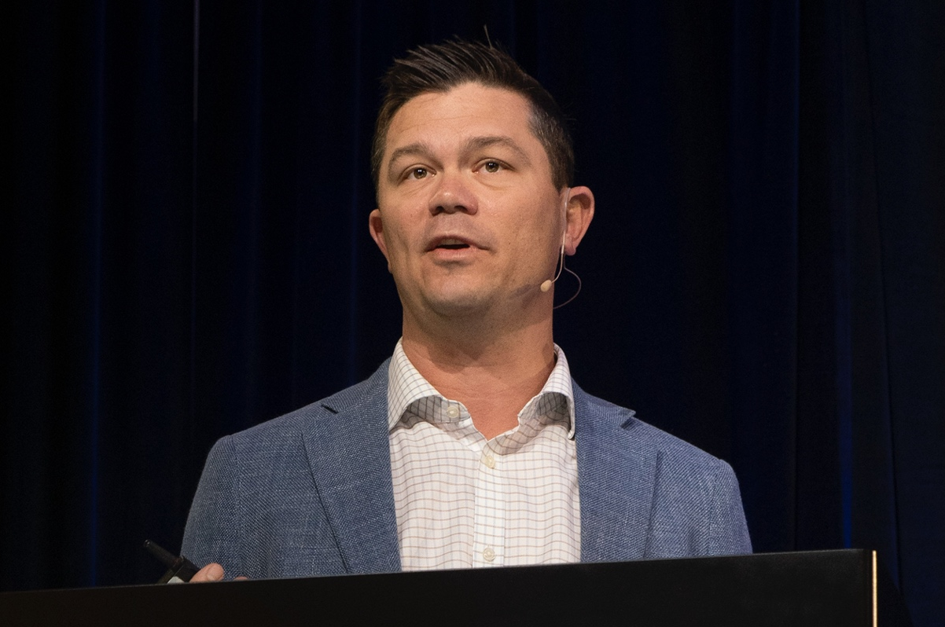
About the Enduring Program
The live meeting is being video and audio recorded.
The proceedings from today will be edited and developed into an enduring web-based program. An email will be sent to all attendees when the activity is available.
To learn more about our education programs, visit our website, www.ResearchToPractice.com
Notes:
22
22

Slide 23

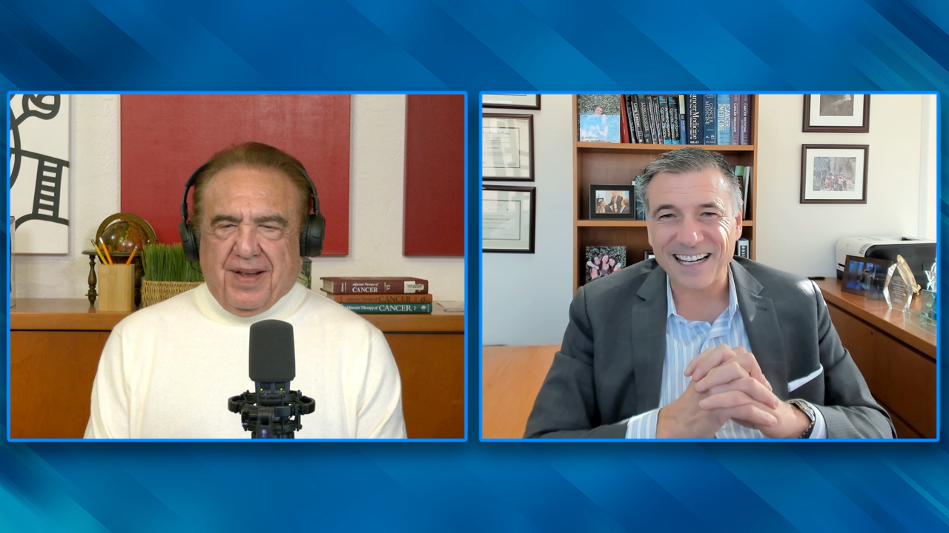

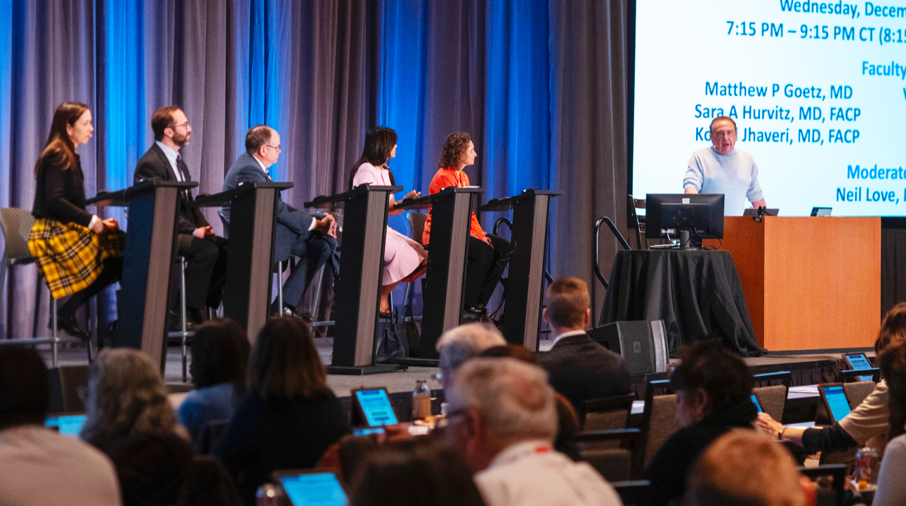
RTP Content Distribution Platform
250 Hours Annually
Interviews | Panels | Meetings
110 hours | 45 hours | 95 hours
Podcast
Website/ App
Email
Streaming Platforms
Social Media
QR Code Cards

Slide 24
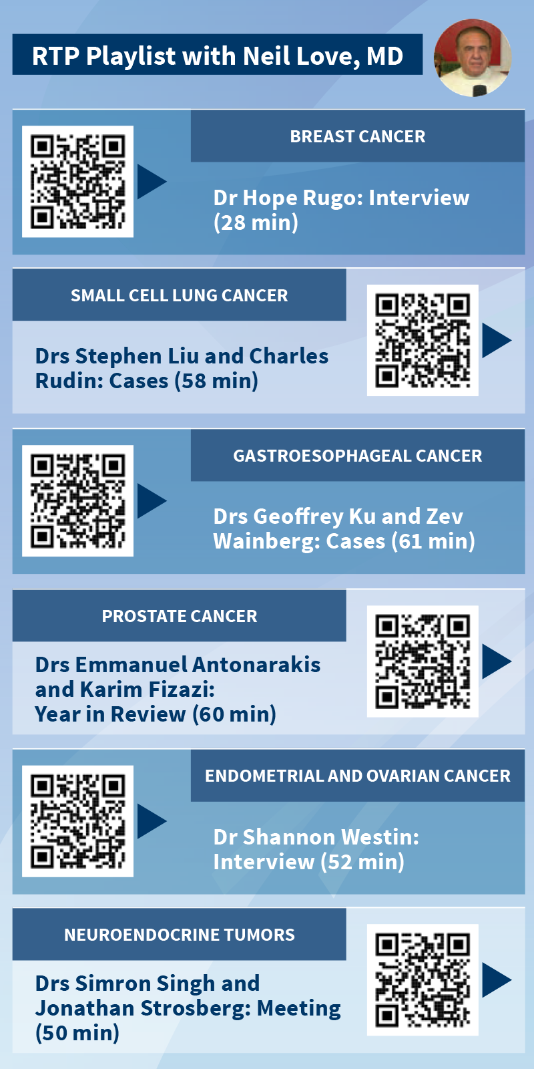
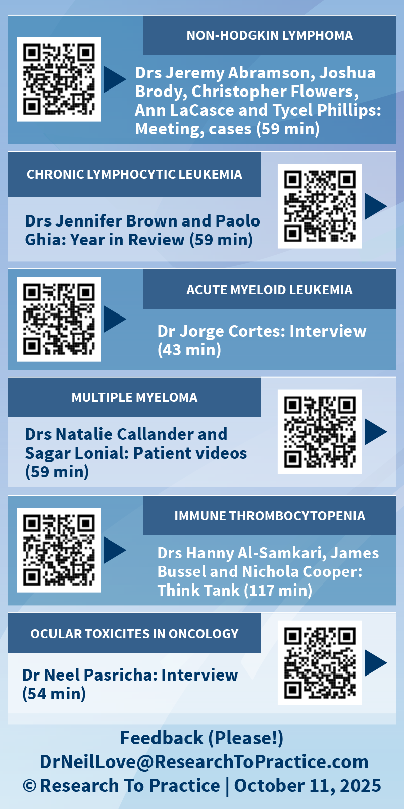

Slide 25
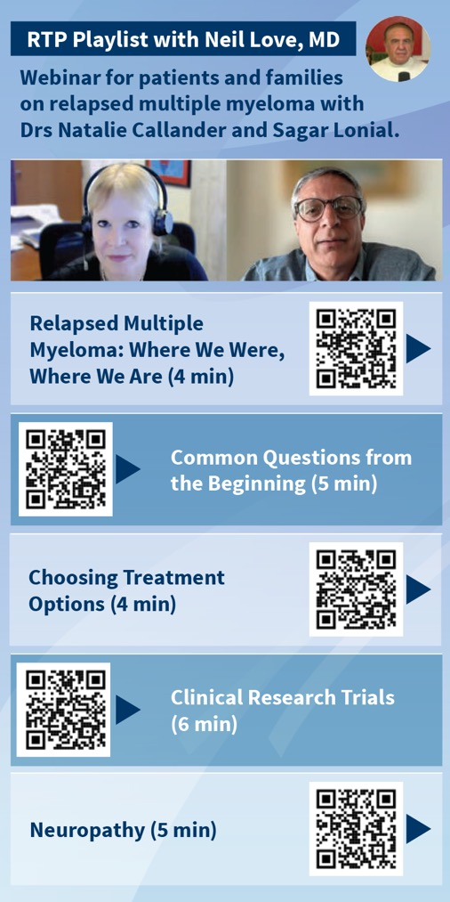
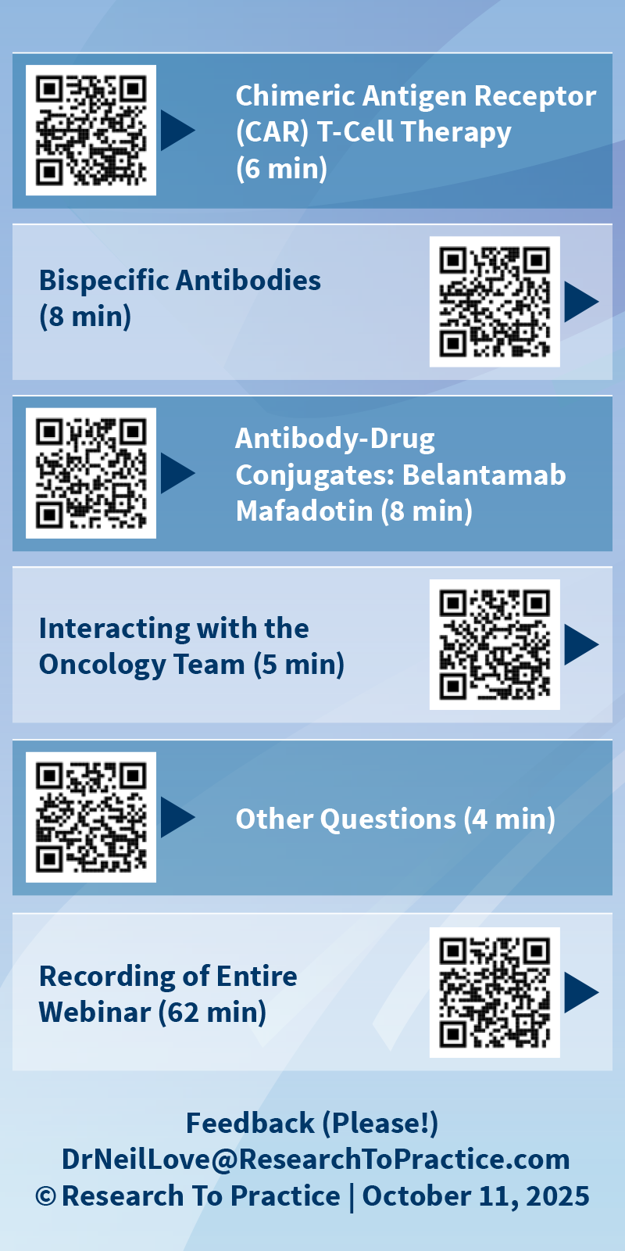

Slide 26






























ASH and SABCS RTP Video Participants

Slide 27

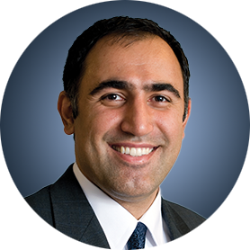


















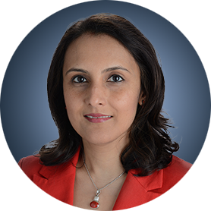





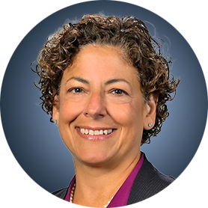


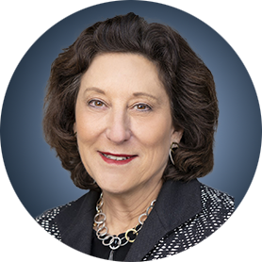





ASH and SABCS RTP Participating Faculty

Slide 28
Expert Second Opinion Investigators Discuss the Optimal Management of Myelofibrosis and Systemic Mastocytosis
A CME-Accredited Friday Satellite Symposium Preceding the 67th ASH Annual Meeting
Friday, December 5, 2025
3:15 PM – 5:15 PM ET
Faculty
Professor Claire Harrison
Andrew T Kuykendall, MD
Stephen T Oh, MD, PhD
Jeanne Palmer, MD
Raajit K Rampal, MD, PhD
Moderator
Neil Love, MD

Slide 29

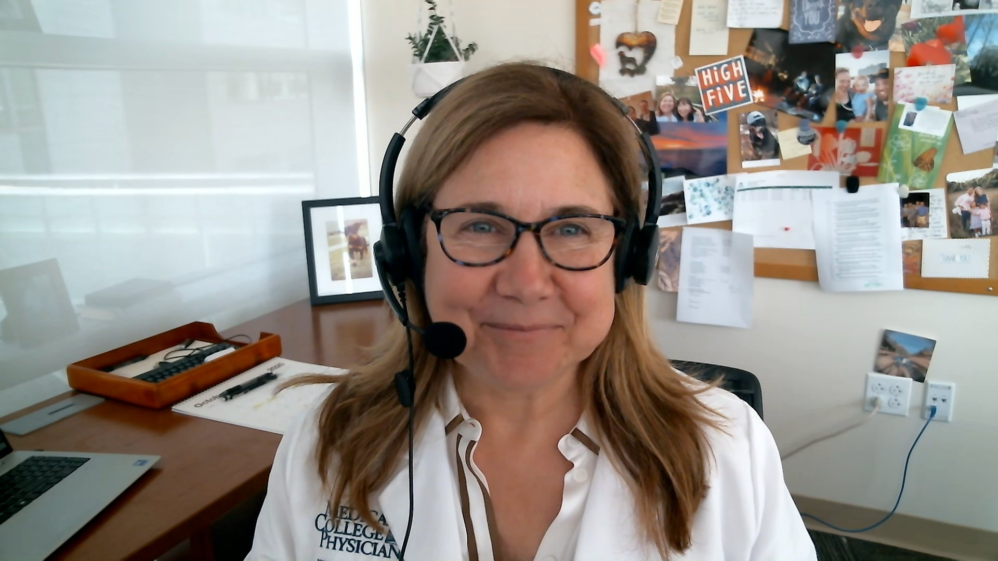

Consulting Faculty
Prithviraj Bose, MD
Professor, Department of Leukemia
Co-Leader, Section of Myeloproliferative Neoplasms
Division of Cancer Medicine
The University of Texas MD Anderson Cancer Center
Houston, Texas
Laura C Michaelis, MD
Armand J Quick Professor of Medicine
Chief, Division of Hematology and Oncology
Department of Medicine
Medical College of Wisconsin
Milwaukee, Wisconsin
John Mascarenhas, MD
Director, Center of Excellence in Blood Cancers and Myeloid Disorders
Director, Adult Leukemia Program
Leader, Myeloproliferative Disorders Clinical Research Program
Division of Hematology/Oncology
Tisch Cancer Institute
New York, New York

Slide 30
Agenda
Module 1: Current Clinical Decision-Making for Myelofibrosis (MF) in the Absence of Severe Cytopenias — Dr Palmer
Module 2: Managing MF in Patients with Anemia — Dr Oh
Module 3: Managing MF in Patients with Thrombocytopenia — Dr Rampal
Module 4: Promising Novel Agents Under Investigation for MF — Prof Harrison
Module 5: Current and Future Management of Systemic Mastocytosis — Dr Kuykendall

Slide 31
Agenda
Module 1: Current Clinical Decision-Making for Myelofibrosis (MF) in the Absence of Severe Cytopenias — Dr Palmer
Module 2: Managing MF in Patients with Anemia — Dr Oh
Module 3: Managing MF in Patients with Thrombocytopenia — Dr Rampal
Module 4: Promising Novel Agents Under Investigation for MF — Prof Harrison
Module 5: Current and Future Management of Systemic Mastocytosis — Dr Kuykendall

Slide 32
Current Clinical Decision-Making for Myelofibrosis (MF) in the Absence of Severe Cytopenias
Jeanne Palmer, MD
Mayo Clinic Arizona

Slide 33

Case Presentation
Patient is a 51 year old female recently diagnosed with myelofibrosis when she presented with a mild anemia and leukocytosis.
-Hgb 11.2
-WBC 15.2, leukoerythroblastic picture
Plt 190
Spleen- 5cm below LCM
JAK2v617f present, no other mutations
Patient reports night sweats and a 15 lb weight loss
HIPAA Compliant Stock photo- not a real patient

Slide 34
NCCN Guidelines: Approach to MF Management
Initial assessment: PASS
Prognosis (prognostic scoring systems)
Anemia / Thrombocytopenia (CBC, EPO)
Systemic Symptoms (MPN-SAF TSS)
Spleen size (exam, US) and related symptoms (MPN-SAF TSS)
Lower Risk MIPSS-70: ≤3
MIPSS-70+ Version 2.0: ≤3
DIPSS-Plus: ≤1
DIPSS: ≤2
MYSEC-PM: <14
Asymptomatic
Observation or clinical trial
Clinical trial, ruxolitinib, PEG-IFNA2a, hydroxyurea¹, pacritinib², or momelotinib (category 2B)
Symptomatic
Transplant Candidate (No)
Clinical trial, or pacritinib (preferred, category 1), or momelotinib (category 2B)
Platelets < 50 x 10⁹/L
Higher Risk MIPSS-70: ≥4
MIPSS-70+ Version 2.0: ≥4
DIPSS-Plus: >1
DIPSS: >2
MYSEC-PM: ≥14
Transplant Candidate (Yes)
Allogeneic HSCT
Transplant Candidate (Yes)
Platelets ≥ 50 x 10⁹/L
Clinical trial, or ruxolitinib (category 1), fedratinib (category 1), momelotinib³, or pacritinib (category 2B)
Transplant Candidate (No)
¹If cytoreduction would help symptoms; ²If platelets < 50 x 10⁹/L; ³Recommended for MF-related anemia with splenomegaly and uncontrolled symptoms
SAF = Symptom Assessment Form; TSS = Total Symptom Score; HSCT = Hematopoietic Stem Cell Transplant; PEG-IFNA2a = Peginterferon alfa-2a NCCN. Clinical Practice Guidelines: Myeloproliferative Neoplasms. Version 2.2025. www.nccn.org. Accessed 12/2025.
Notes:
https://www.nccn.org/professionals/physician_gls/pdf/mpn.pdf

Slide 35
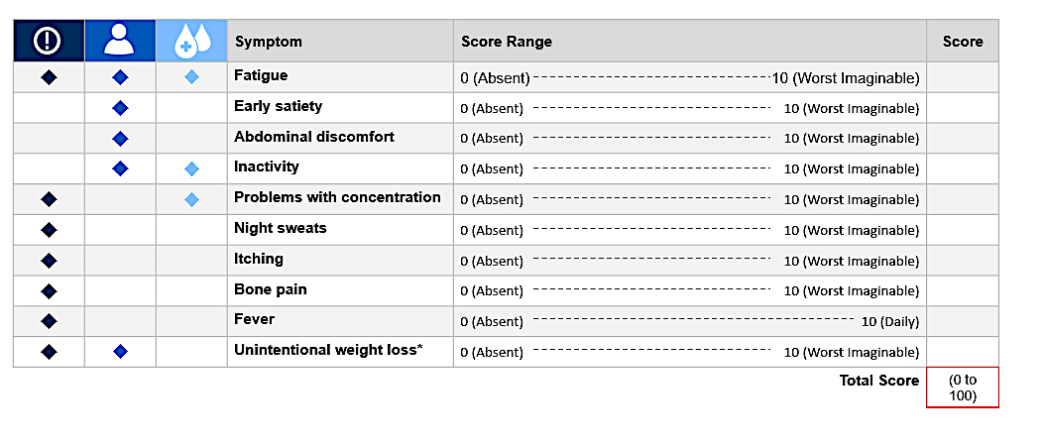
To treat or not to treat?
Symptoms and enlarged spleen

Slide 36
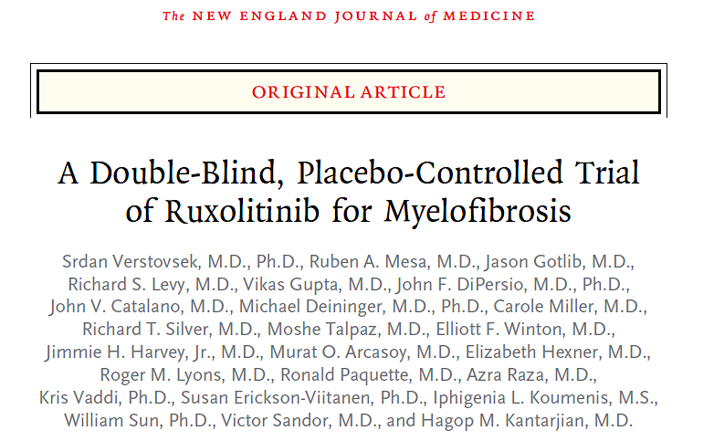
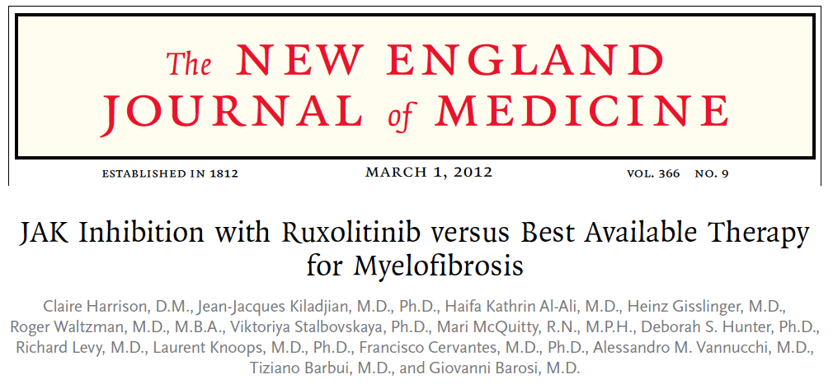
Ruxolitinib (oral)
BID
Patients
with MF
(N = 309)
Randomized
1:1
Placebo (oral)
BID
Ruxolitinib (oral)
BID
Patients
with MF
(N = 219)
Randomized
2:1
BAT

Slide 37
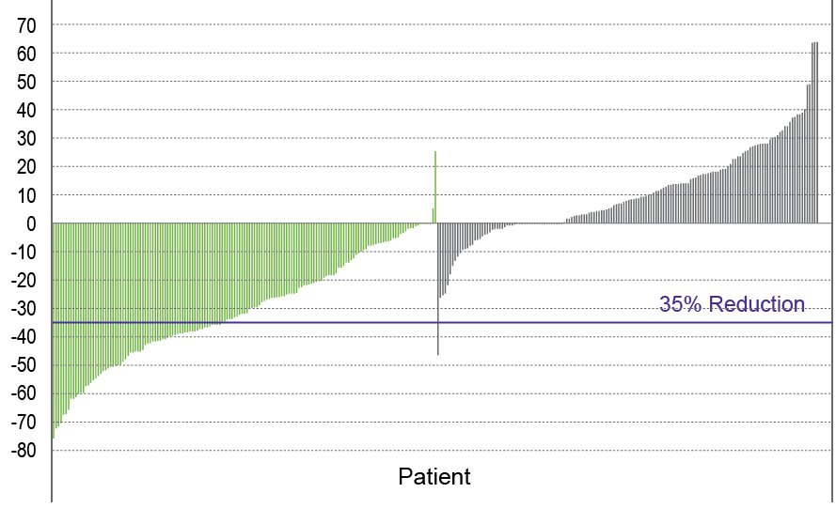
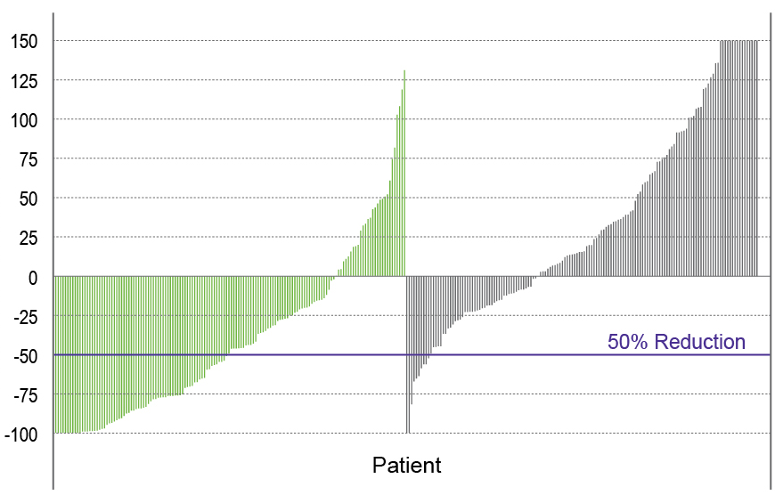
COMFORT-I: Key Efficacy Endpoints
Ruxolitinib
(n=155)
Placebo
(n=153)
TSS at 24 Weeks
SVR at 24 Weeks
Ruxolitinib
(n=145)
Placebo
(n=145)
Percent Change From Baseline
Percent Change From Baseline
41.9% ruxolitinib vs 0.7% placebo achieved SVR35ª; P<0.001
OR, 134.4 (95% CI: 18, 1004.9); P<0.001
OR, 15.3 (95% CI: 6.9-33.7); P<0.001
ªChanges in palpable spleen length in the ruxolitinib and placebo groups mirrored the changes in spleen volume
Verstovsek S, et al. N Engl J Med. 2012;366(9):799-807.

Slide 38
COMFORT-II: Efficacy Results
Ruxolitinib Provided Significant Spleen Volume Reduction¹
Overall Survival at Median Follow-Up 4.3 Years²
1.0
mOS
Rux=not reached
BAT (ITT)=4.1 y
BAT (RPSFT)=2.7 y
HR, 0.67; 95% CI, 0.44-1.02; P=0.06
Results at 48 weeks
0.8
HR 0.67, 95% CI: 0.44-1.02, P=0.06
≥35% Reduction in Spleen Volume at 48 Weeks (%)
P<0.001
0.6
Rux
Probability
BAT (ITT)
0.4
BAT (RPSFT)
n=
0.2
146 73 73
130 58 59
109 48 42
100 35 6
88 30 5
61 22 4
0 0 0
0.0
0
1
2
3
4
5
6
Time, y
Median time to response was 12 weeks¹
33% reduced risk of death among patients treated with ruxolitinib vs those treated with BAT²
Most patients in the BAT arm crossed over to receive ruxolitinib
RPSFT, rank-preserving structural failure time
¹Harrison C, et al. N Engl J Med. 2012;366(9):787-798. 2. Harrison CN, et al. Leukemia. 2016;30(8);1701-1707.

Slide 39
Achieving a Spleen Response is Associated With Improved Overall Survival
Achieving ≥50% reduction in palpable spleen length was associated with longer survival compared with <25% reduction
Overall Survival by degree of spleen length reductionª
1.0
0.8
0.6
Probability of Survival
0.4
0.2
<25% spleen length reduction (n=23)
>25% but <50% spleen length reduction (n=13)
≥50% spleen length reduction (n=61)
P<0.0001^{b}
0
0
6
12
18
24
30
36
42
48
Months
ª 97 patients with myelofibrosis enrolled at the Mayo Clinic Rochester on a study INCB18424-251 of ruxolitinib. ^{b} Comparison of <25% reduction with ≥50% reduction, hazard ratio=0.22, 95% CI, 0.10-0.51.
Verstovsek S, et al. Blood. 2012;120:1202-1209.

Slide 40
COMFORT Studies: Ruxolitinib Overcomes Adverse Prognostic Effect of Anemia in MF
OS
100
80
RUX (drop in Hb ≤30 g/L, n = 121)
RUX (drop in Hb >30 g/L, n = 124)
BAT (drop in Hb ≤30 g/L, n = 143)
60
Survival Probability
BAT (drop in Hb >30 g/L, n = 29)
40
20
0
0
50
100
150
Time, wk
Anemia is not a contraindication for ruxolitinib use
Hb changes on ruxolitinib treatment do not bear the same prognostic implications as Hb changes that occur as a consequence of MF pathology
Al-Ali HK, et al. Leuk Lymph. 2016;57:2464-2467.; Gupta V, et al. Haematologica. 2016;101:e482-e484.
Notes:
BAT, best available therapy; Hb, hemoglobin; MF, myelofibrosis; Rux, ruxolitinib.

Slide 41
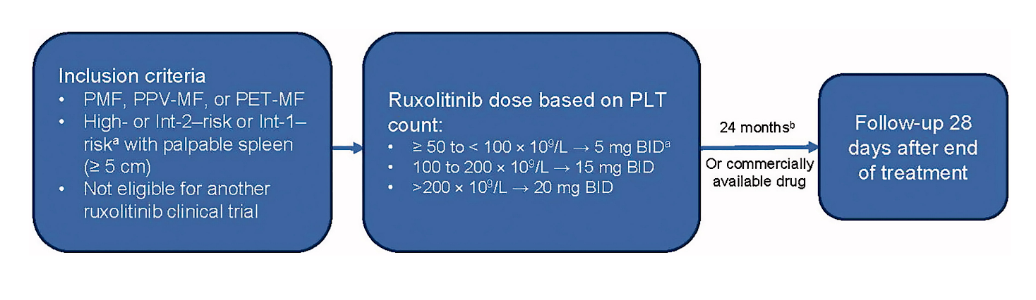
JAK Inhibitor Ruxolitinib in Myelofibrosis Patients; NCT01493414 — JUMP study
A phase 3b expanded-access study in MF in countries without access to ruxolitinib outside a clinical trial
Primary endpoint: safety
Secondary endpoint: # of patients who achieved SVR of 50%, and reduction in PRO
Br J Haematol, Volume: 189, Issue: 5, Pages: 888-903, First published: 04 February 2020, DOI: (10.1111/bjh.16462)

Slide 42
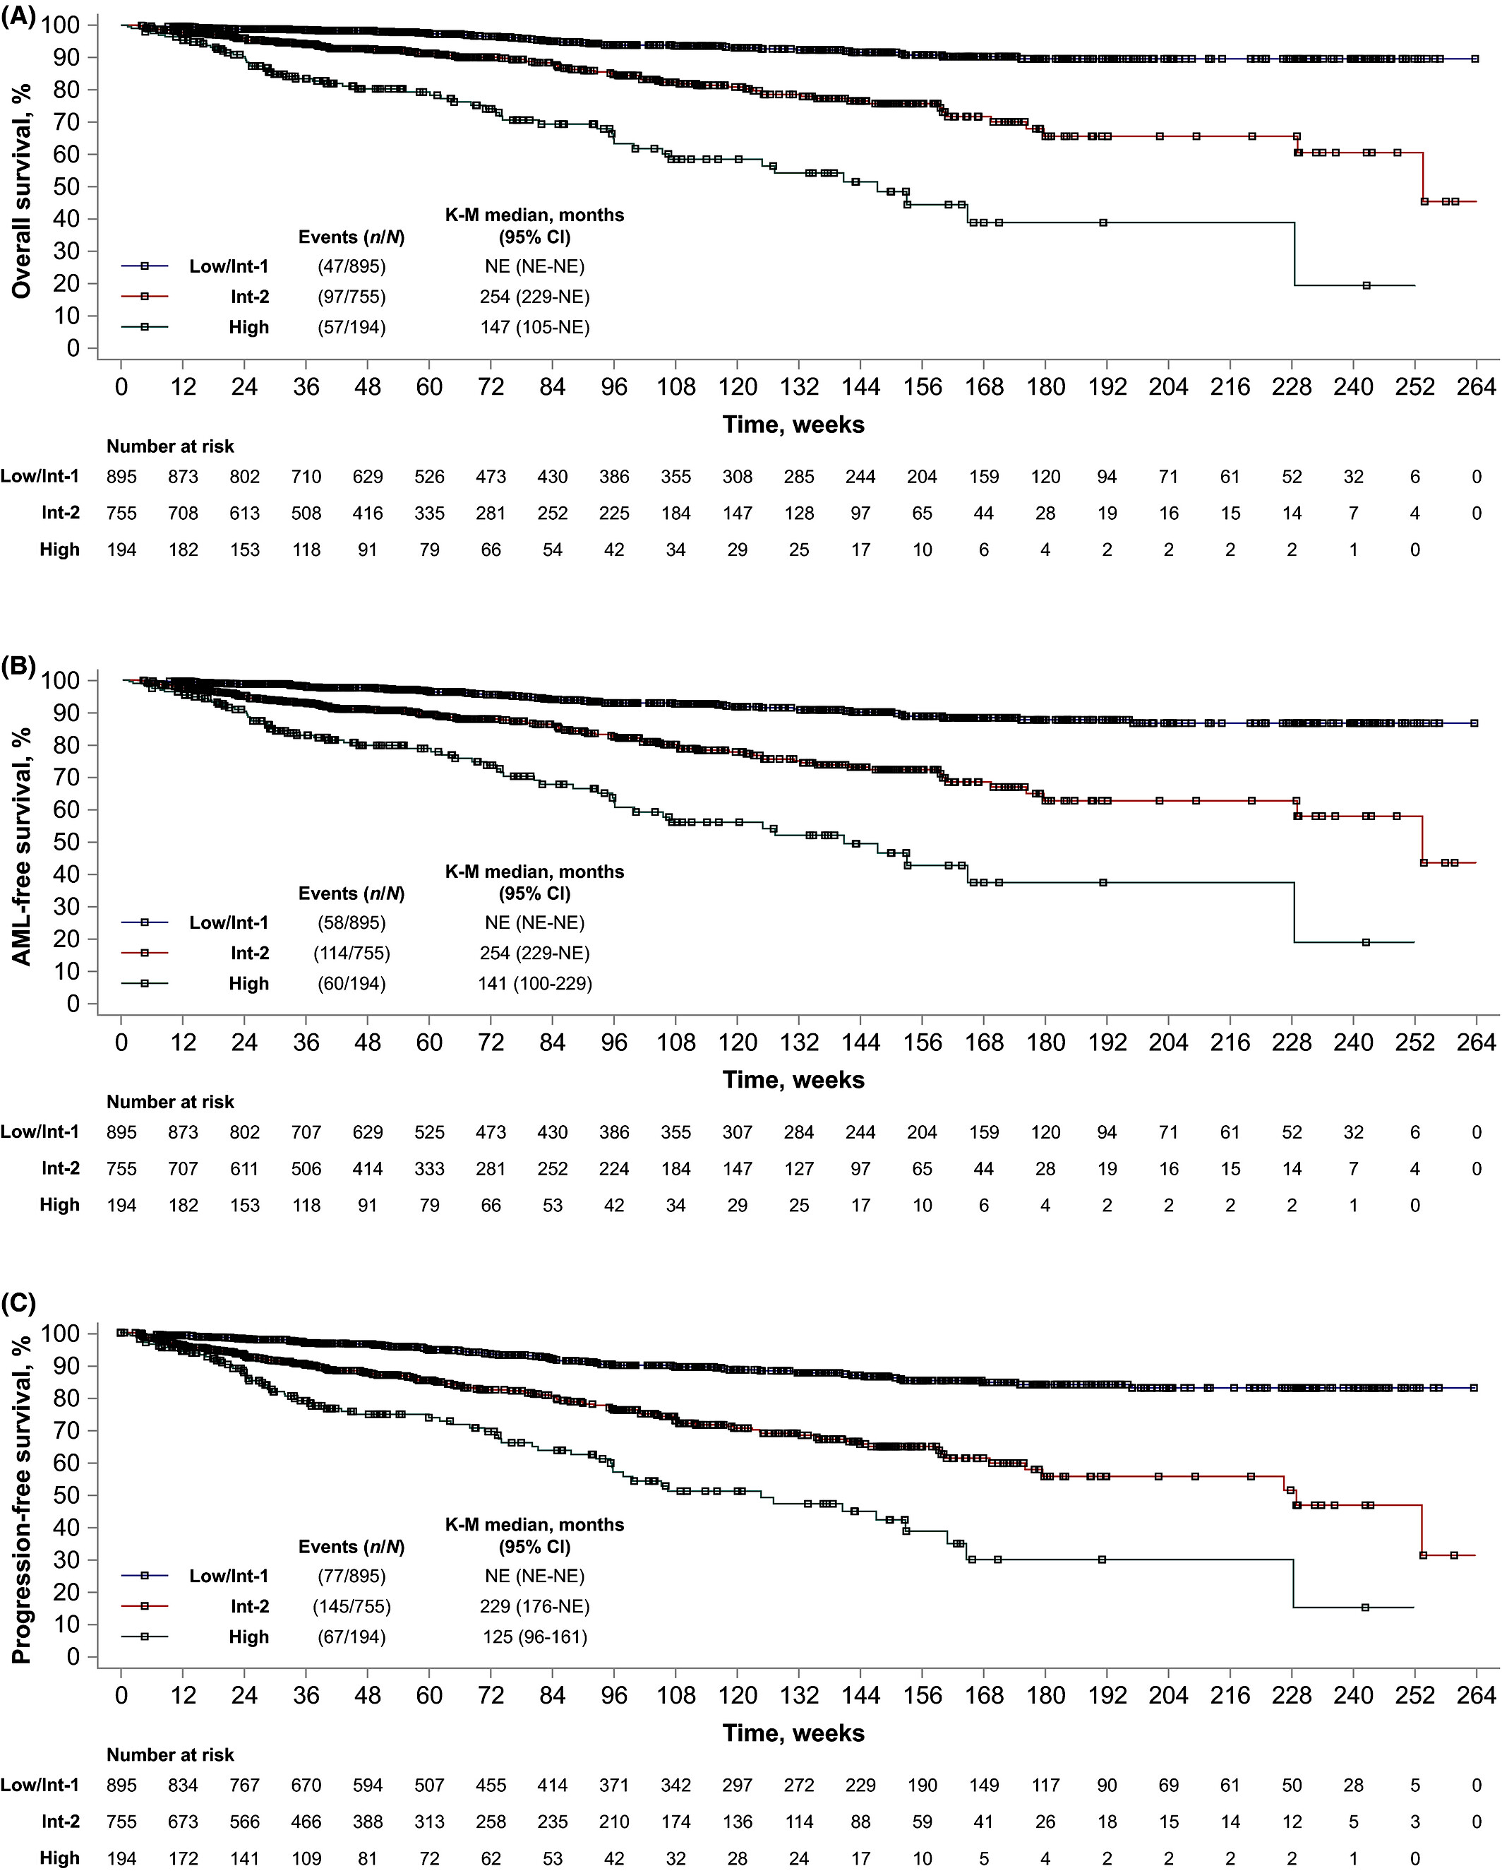
JUMP study
DIPSS | N (%)
Low/Int-1 risk | 895 (40.1)
Int-2 risk | 755 (33.8)
High Risk | 194 (8.7)
Missing | 389 (17.4)
Platelet count | N (%)
50- 75 | 28 (1.3)
75-100 | 109 (4.9)
100-200 | 689 (30.9)
>200 | 1398 (62.6)
Br J Haematol, Volume: 189, Issue: 5, Pages: 888-903, First published: 04 February 2020, DOI: (10.1111/bjh.16462)

Slide 43
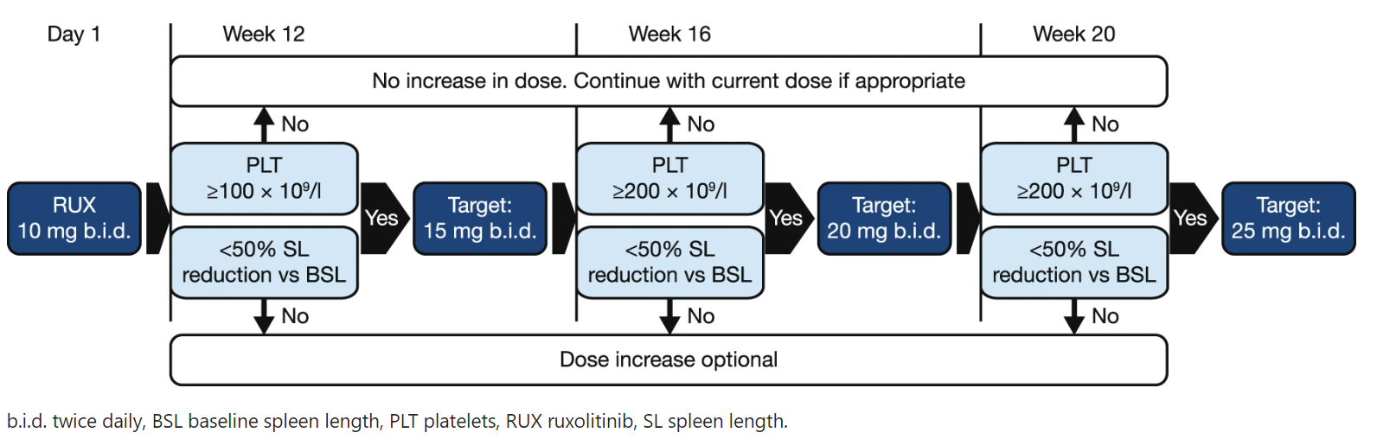
Dosing Ruxolitinib in anemia — REALISE study
Cervantes et al. Leukemia volume 35, pages3455–3465 (2021)

Slide 44
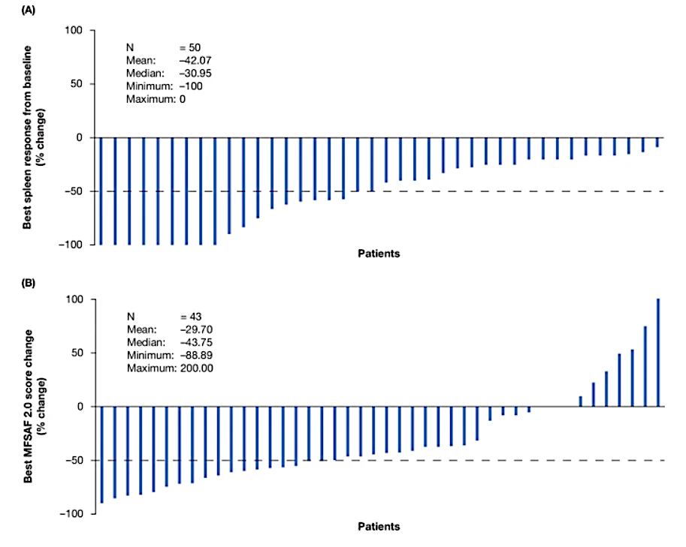
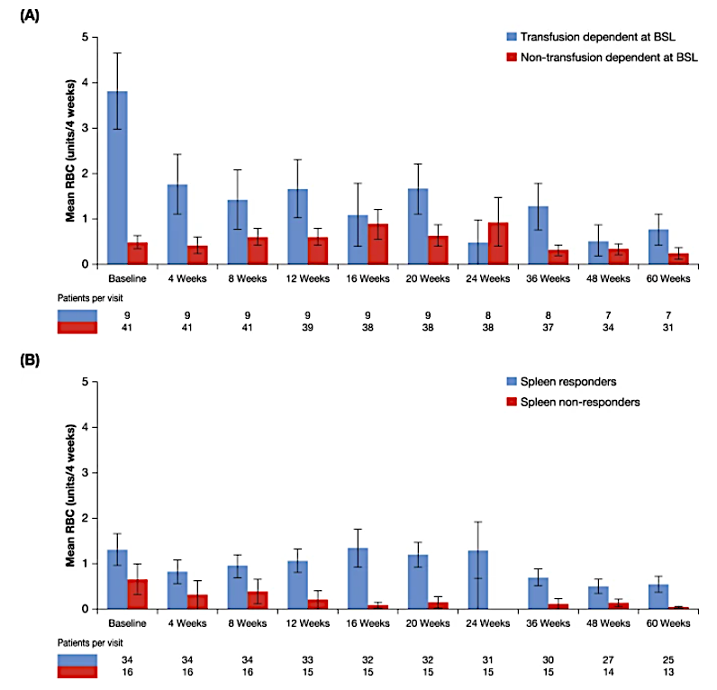
Results
A total of 70% (35/50) of patients achieved a ≥50%
Cervantes et al. Leukemia volume 35, pages3455–3465 (2021)
Cervantes et al. Leukemia volume 35, pages3455–3465 (2021)

Slide 45
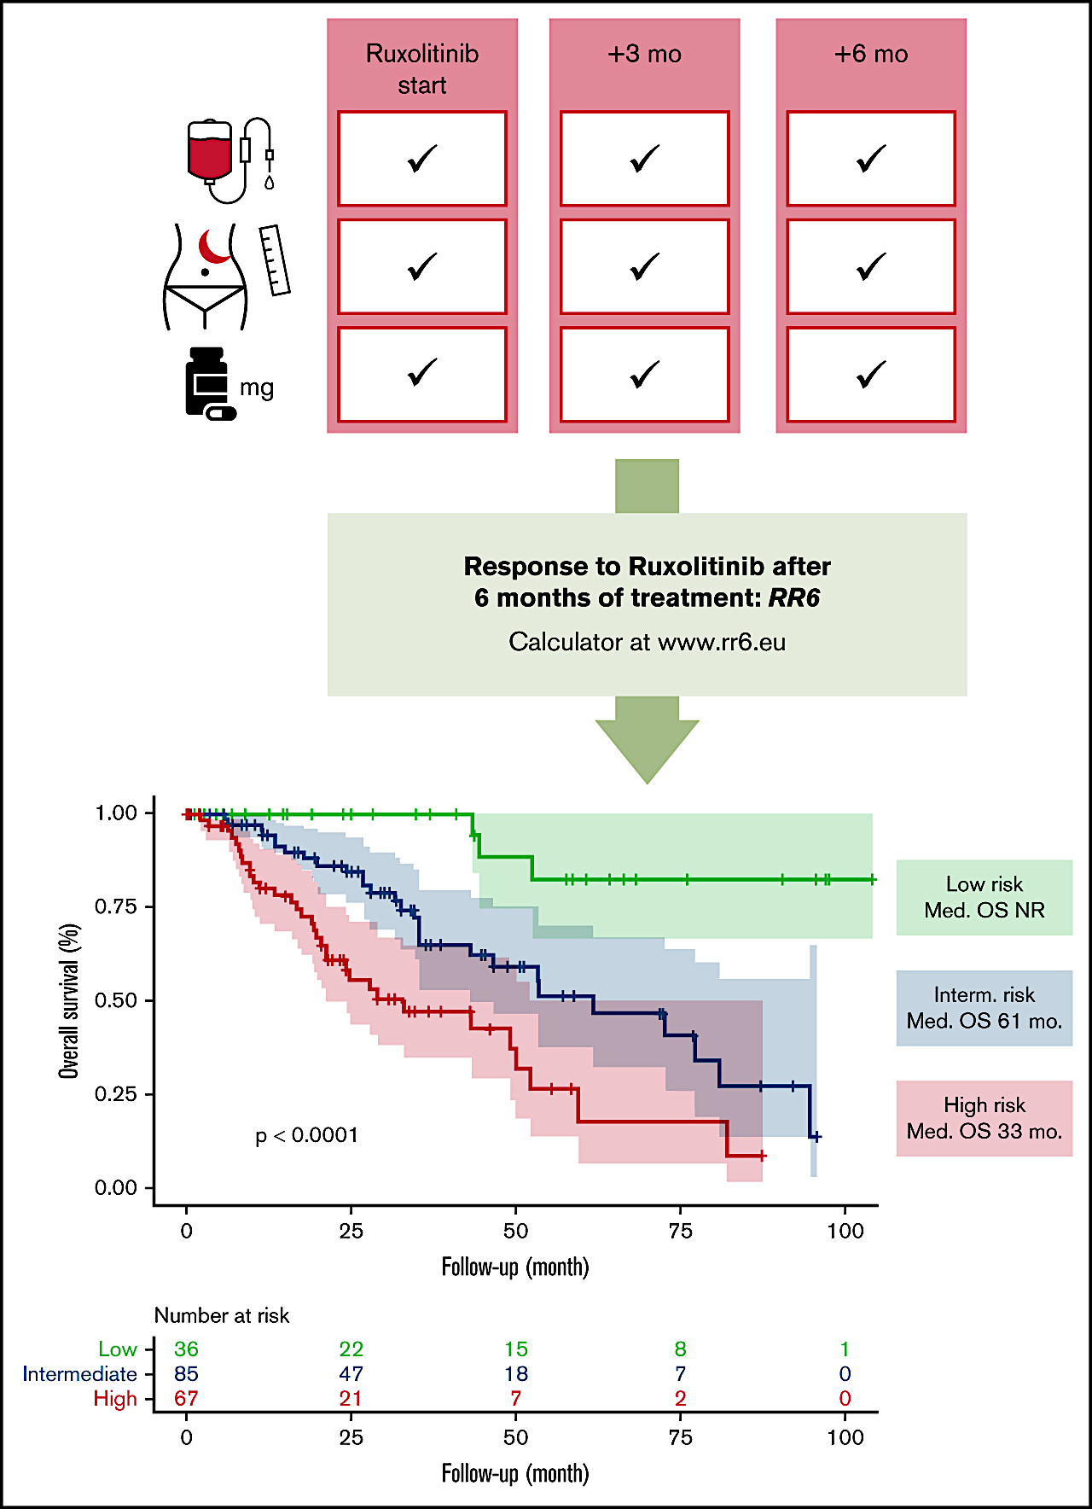
A prognostic model to predict survival after 6 months of ruxolitinib in patients with myelofibrosis
209 RUX-treated MF patients entered the analysis
1 point
Receiving RUX at a dose <20mg twice daily at all time points
RBC transfusion requirement at 3 and/or 6 months
1.5 points were assigned to
Obtaining a palpable spleen length reduction ≤30% with respect to baseline at months 3 and 6
Needing RBC transfusions at all time points
0
1-2
≥2.5
Maffioli et al. Blood Adv (2022) 6 (6): 1855–1864

Slide 46
JAKARTA: Phase 3 Study Design
Week 24 or disease progression before week 24: crossover to fedratinib
400 or 500 mg (1:1)
Placebo
Daily oral doses, 4-week cycle
Aged ≥18 years
Diagnosis of
PMF
Post-PV MF
Post-ET MF
Intermediate-2 or high-risk status
Splenomegaly
Fedratinib 400 mg
Daily oral doses, 4-week cycle
R
Week 24
(EOC6)
EOT
Fedratinib 500 mg
Daily oral doses, 4-week cycle
1 cycle = 4 weeks
Pardanani A, et al. JAMA Oncol. 2015;1:643-651.; Harrison CN, et al. Lancet Haematol. 2017;4:e317-e324.

Slide 47
JAKARTA-1: Baseline Characteristics
Key Baseline Characteristics | JAKARTA-1
Key Baseline Characteristics | Fedratinib 400/500 (n=96/n=97) | Placebo n=154
Median age, years | 63/65 | 66
Male, % | 56/63 | 57
MF diagnosis: PMF, PPV-MF, PET-MF, % | 65/65, 25/26, 10/9 | 60, 28, 11.5
IPSS risk status: Int-2, High, % | 59.0/48.5, 41.0/51.5 | 48, 52
Median palpable length, cm | 16/14 | 17
Median volume, cm | 2652/2366 | 2660
Median platelet count, x10⁹/L <100x10⁹/L , % ≥100x10⁹/L, % | 221/241 15/15 85/85 | 187 20 80
Median hemoglobin, g/dL | 10.7/9.8 | 10.1
Int, intermediate; IPSS, International Prognostic Scoring System; MF, myelofibrosis; NR, not reached; PET-MF, postessential thrombocythemia MF; PMF, primary MF; PPV-MF, postpolycythemia vera MF.
Pardanani A, et al. JAMA Oncol. 2015;1:643-651.; Harrison CN, et al. Lancet Haematol. 2017;4:e317-e324.

Slide 48
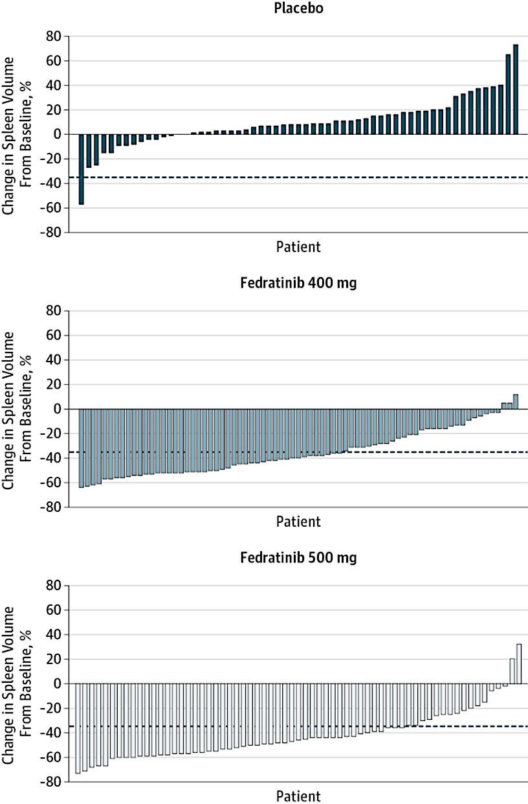
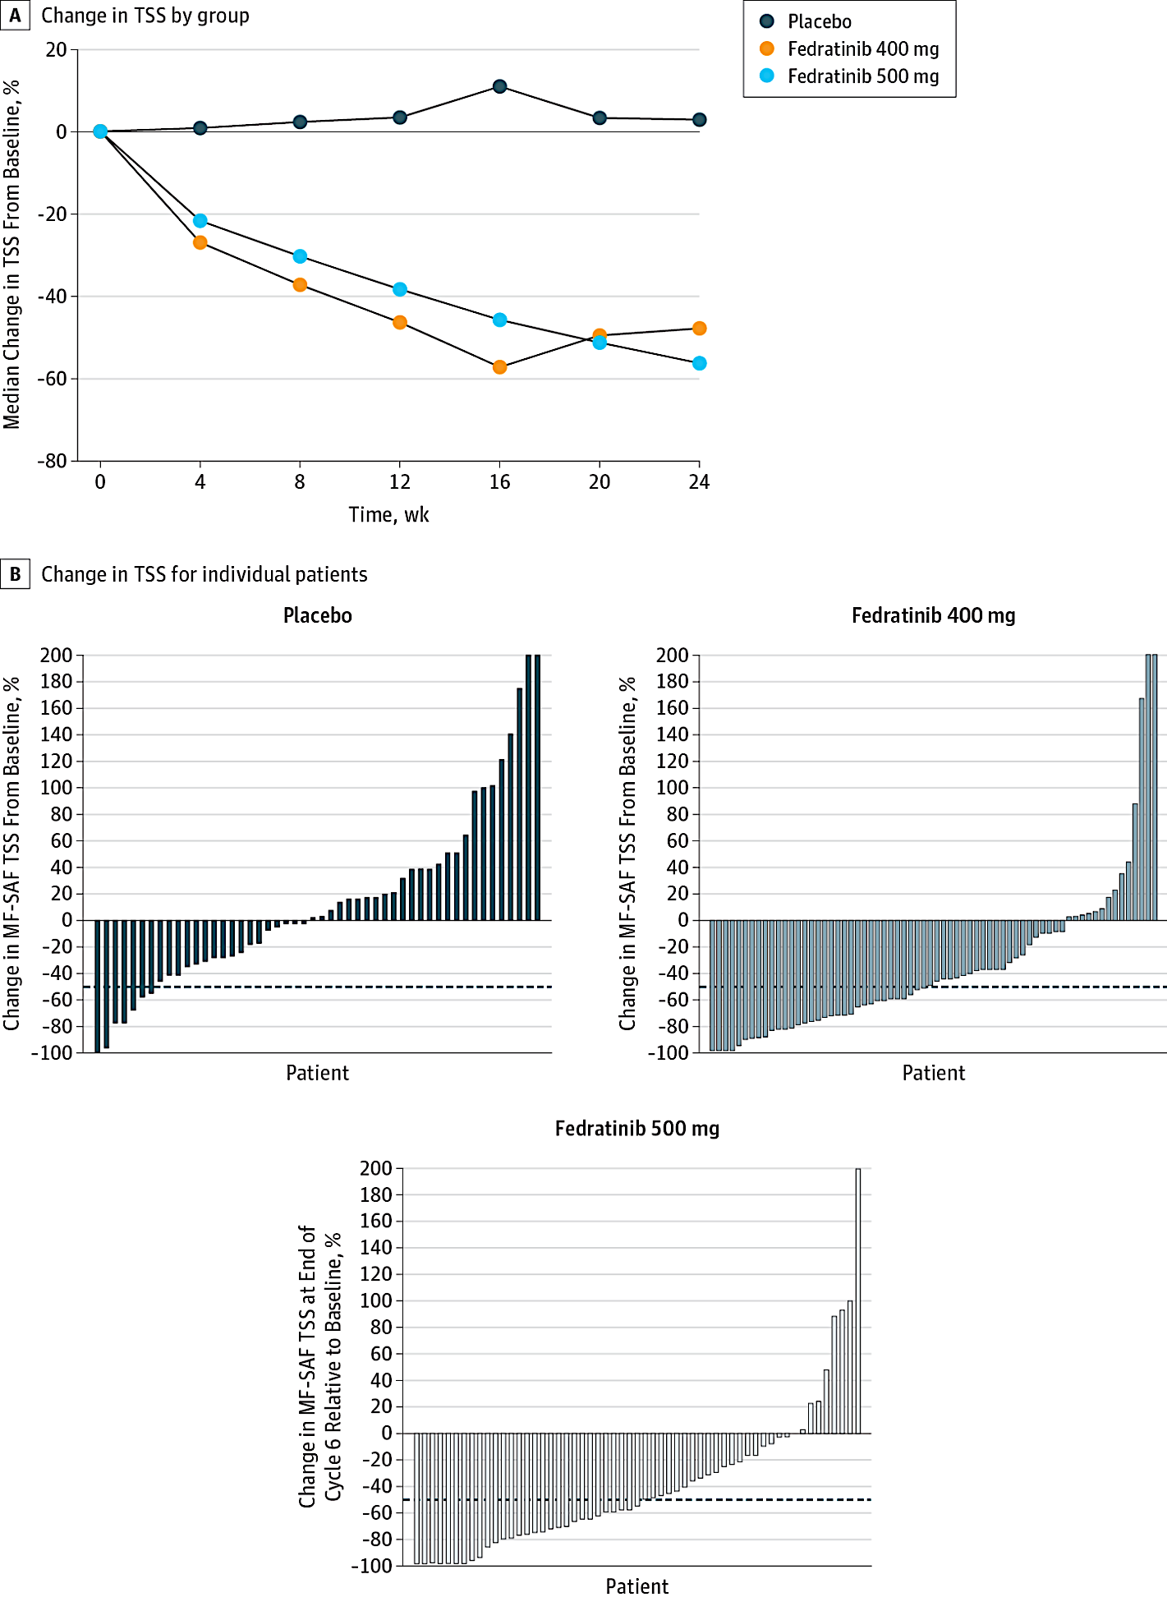
JAKARTA-1: Key Efficacy Endpoints
≥35% SVR at 24 Weeks
≥50% Reduction in TSS at 24 Weeks
Placebo (n=96)
Placebo (n=85)
7%
1%
Fedratinib 400 mg (n=96)
Fedratinib 400 mg (n=91)
36%, P<0.001
36%, P<0.001
Fedratinib 500 mg (n=97)
Fedratinib 500 mg (n=91)
40%, P<0.001
SVR, spleen volume reduction; TSS, total symptom score.
Pardanani A, et al. JAMA Oncol. 2015;1:643-651.
34%, P<0.001

Slide 49
JAKARTA-1: Hematologic/Nonhematologic Adverse Reactions
Hematologic Adverse Reactionsª | Fedratinib 400/500 (n=96/n=97) |  | Placebo n=95
 | All Grades, % | Grade 3/4, % | All Grades, % | Grade 3/4, %
Thrombocytopenia | 63/57 | 17/27 | 51 | 9
Anemia | 99/98 | 43/60 | 91 | 25
Neutropenia | 28/44 | 8/18 | 15 | 4
Nonhematologic Adverse Reactions | Fedratinib 400/500 |  | Placebo
Nonhematologic Adverse Reactions | All Grades, % | Grade 3/4, % | All Grades, % | Grade 3/4, %
Diarrhea | 66/56 | 5/5 | 16 | 0
Vomiting | 42/55 | 3/9 | 5 | 0
Nausea | 64/51 | 0/6 | 15 | 0
Constipation | 10/18 | 2/0 | 7 | 0
Asthenia | 9/16 | 2/4 | 6 | 1
Abdominal pain | 15/12 | 0/1 | 16 | 1
Fatigue | 16/10 | 6/5 | 10 | 0
Dyspnea | 8/10 | 0/1 | 6 | 2
Weight decrease | 4/10 | 0/0 | 5 | 0
ª Presented values are worst grade values regardless of baseline (NCI Common Terminology Criteria for AEs, version 3.0). FDA places clinical hold on fedratinib in November 2013 because of WE (n=7 patients)
Pardanani A, et al. JAMA Oncol. 2015;1:643-651.; Scott BL, et al. JAMA Oncol. 2015;1:651-652.

Slide 50
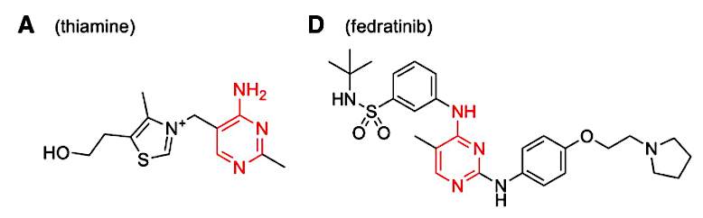

Fedratinib Considerations
Black Box Warning!
Wernike’s encephalopathy (WE) (ataxia, altered mental status, ophthalmoplegia) occurred in 8 of 608 (1.3%) patients receiving fedratinib in clinical trials
Expert review:
• 3 cases weren’t WE
• 1 cases confirmed WE based on MRI in patient with significant GI toxicity
• 2 cases confirmed WE resolved without holding fedratinib
• 2 cases indeterminate
Check thiamine when starting fedratinib and periodically during treatment
If patient experiences neurologic symptoms consistent with WE, hold fedratinib and give IV thiamine
Do not start fedratinib in patients with thiamine deficiency; replete thiamin prior to treatment initiation
Zhang Q, et al. Drug Metab Dispos. 2014;42(10):1656-1662.
Harrison C, et al. Blood. 2017;130 (Supplement 1):4197.

Slide 51
JAKARTA: Progression-Free Survival
Fedratinib significantly reduced the risk of disease progression vs placebo (P = .004)
Median PFS was 5.7 mo longer with fedratinib vs placebo (23.2 vs 17.5 mo, respectively)
1-year PFS: fedratinib 83%, placebo 67%
80 patients (42%) were still being followed for PFS at the time of clinical hold
Median follow-up: fedratinib 10.6 mo; placebo, 9.1 mo
AML transformation reported in 3 patients (3%) who received fedratinib and 2 patients (2%) in the placebo armª
JAKARTA: PFS
Fedratinib 400 mg (N = 96)
Placebo (N = 96)
Censored (not due to clinical hold)
Censored (due to clinical hold)
23.2 mo
(95% CI, 17.1-23.7)
17.5 mo
(95% CI, 15.9-22.7)
 | Fedratinib (n = 96) | Placebo (n = 96)
Events, n (%) | 18 (19) | 34 (35)
Censored, n (%) | 78 (81) | 62 (65)
HR = 0.42
(95% CI, 0.23-0.76)
P = .004^{b}
No. at Risk
Fedratinib | 96 | 86 | 70 | 61 | 40 | 31 | 4 | 2 | 0
Placebo | 96 | 70 | 51 | 49 | 33 | 28 | 9 | 3 | 0
ª AML transformation was based on AE reporting, including the preferred terms of “acute myeloid leukemia,” “acute leukemia,” and “transformation to acute myeloid leukemia.” ^{b} P value from log-rank test.
Harrison C, et al. EHA 2021. Abstract S203.
Notes:
42% of patients in the fedratinib 400 mg and placebo arms in JAKARTA were still being followed for progression-free survival at the time of the clinical hold.
PFS was significantly extended in patients randomized to fedratinib compared with PFS in patients randomized to placebo: 23.2 months vs 17.5 months—even thought patients randomized to placebo may have crossed over to fedratinib. This finding suggests earlier fedratinib use in these patients may have been beneficial.
AML transformation rates were similar between treatment arms (keeping in mind that treatment exposure was greater in the fedratinib 400 mg arm).
Note: Sample sizes and heavy censoring precluded meaningful comparison of potential correlations between survival outcomes and clinical response (spleen volume changes).

Slide 52
Defining Treatment Failure in Clinical Practice
Primary resistance/refractoriness
Relapse or loss of initial response; secondary resistance
Intolerance/treatment-related toxicities
Treatment discontinuation/withdrawal
Disease progression
No change in spleen size or reduction in symptoms
At dose reduction or on stable dose; symptom & spleen return to baseline
Myelosuppression, early-onset cytopenias (including increase in transfusion requirements), bleeding, infections
Accelerated-phase disease, leukemic transformation (increase in blast percentage), late-onset cytopenias
Harrison CN, et al. Ann Hematol. 2020;99:1177-1191; Pardanani A, et al. Blood Cancer J. 2014;4:e268; McLoman DP, et al. Blood Adv. 2024;4:607-610.

Slide 53
Prognosis After Ruxolitinib Discontinuation¹
1.0
HR = 4.1 (95% CI, 1.8-9.5); P = .001
1.0
HR = 2.7 (95% CI, 1.3-5.8); P = .006
0.8
PLT ≥100
0.8
No clonal evolution at follow-up
0.6
PLT <100
0.6
Clonal evolution at follow-up
Cumulative Survival
Censored
Cumulative Survival
Censored
0.4
0.4
0.2
0.2
0
0
0
12
24
36
48
60
72
0
12
24
36
48
60
72
Survival After Discontinuation, mo
Survival After Discontinuation, mo
PLTs <100 median survival: 11/12
Clonal evolution median survival: 6/12
No. at Risk
No. at Risk
PLT ≥100
PLT <100
23
33
12 10
7
4
4
0
3
1
0
No clonal evolution
Clonal evolution
28
14
16
3
4
3
4
1
2 0
1
0
Survival after ruxolitinib discontinuation is poor¹⁻³
Salvage therapy or rechallenge with ruxolitinib can provide responses after discontinuation⁴
This continues to be an area of unmet clinical need in MF
1. Newberry KJ et al. Blood. 2017;130:1125-1131. 2. Kuykendall AT et al. Ann Hematol. 2018;97:435-441. 3. Palandri F et al. Cancer. 2020;126:1243-1252. 4. Gerds A et al. Clin Lymphoma Myeloma Leuk. 2018;18:e463-e468.

Slide 54
JAKARTA-2 Reanalysis Confirmed the Benefit of Post-Ruxolitinib Therapy with Fedratinib¹
In original JAKARTA-2 analysis, fedratinib demonstrated a 55% rate of SVR₃₅ in patients resistant/intolerant to RUX on per protocol analysis
Reanalysis employed a more stringent definition of RUX failure
Main findings
79/97 enrolled patients (81%) met the more stringent criteria for RUX R/R (n = 65, 82%) or intolerance (n = 14, 18%)
Clinically meaningful reductions in splenomegaly and symptom burden in patients with MF who met more stringent criteria
SVRR: 30%
Symptom RR: 27%
Safety consistent with prior reports
Spleen Volume and Symptom Response Rates
 | ITT Population (N = 97) |  | RUX Failure Cohort (n = 79) |  | Sensitivity Cohort (n = 66)
 | N | Patients, % (95% CI) | N | Patients, % (95% CI) | N | Patients, % (95% CI)
SVRR | 97 | 31 (22%-41%) | 79 | 30 (21%-42%) | 66 | 36 (25%-49%)
Symptom RR | 90 | 27 (18%-37%) | 74 | 27 (17%-39%) | 62 | 32 (21%-45%)
1. Harrison CN et al. Am J Hematol 2020;95(6):594-603.

Slide 55
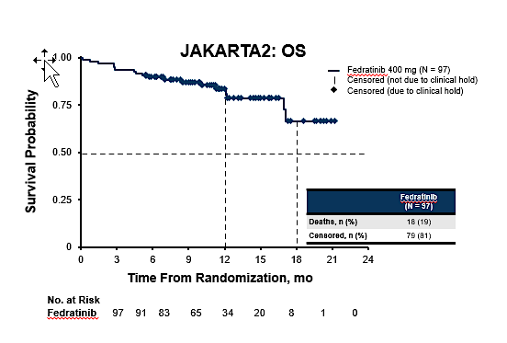
JAKARTA-2: Fedratinib Is an Effective Option in Patients With MF Progressing on Ruxolitinib¹
97 patients with int-1 with symptoms, int-2 or high-risk PMF, pos-PV MF, or post-ET MF
Median OS was NR (95% CI, 17.1-NR)
1-year and 18-mo OS rates were 84% and 67%, respectively
79 patients (81%) were censored for OS at the time of clinical hold
Median follow-up: 10.8 mo
1.00
1. Harrison C et al. EHA 2021. Abstract S203.

Slide 56
Conclusions and future directions
Ruxolitinib remains the frontline agent for treatment of myelofibrosis
Progression on ruxolitinib is associated with a poor prognosis
Fedratinib is a good second line choice for those with adequate blood counts and has shown efficacy in ruxolitinib failures
Future therapies that focus on improving duration of response disease modification are needed

Slide 57
Case Presentation: 75-year-old woman presents with symptomatic JAK2 V617F-mutant primary MF with mild anemia (Hgb 9.9) and normal platelet count
Dr John Mascarenhas (New York, New York)

Slide 58
QUESTIONS FOR THE FACULTY
What is the optimal initial JAK inhibitor for this symptomatic patient with DIPPS high-risk, JAK2-mutated primary MF?
In your experience, how likely are patients with treatment-naïve MF to respond to ruxolitinib and/or achieve meaningful clinical benefit? Do you still consider ruxolitinib to be the “best-in-class” JAK inhibitor?
What have you observed in terms of quality-of-life side effects with ruxolitinib, such as bruising, dizziness and headaches?

Slide 59
Asymptomatic patients with MF; re-reads of pathology reports; “triple-negative” MF, secondary causes
Dr Laura Michaelis (Milwaukee, Wisconsin)

Slide 60
QUESTIONS FOR THE FACULTY
What is your threshold for initiating active treatment for patients with intermediate-1-, intermediate-2- and high-risk MF, respectively? In what situations, if any, will you recommend a JAK inhibitor to an asymptomatic patient with MF? What about for a patient with low-risk disease? Is there an advantage to early intervention versus observation for certain patients?
When do you obtain re-reads of pathology reports for your patients with MF, and how often does this result in a change in treatment recommendations?
What secondary causes of MF should be looked for in “triple-negative” disease?

Slide 61
Ruxolitinib-associated dermatologic cancers, weight gain
Dr Prithviraj Bose (Houston, Texas)

Slide 62
QUESTIONS FOR THE FACULTY
What is known about MF-associated second cancers, including pathogenesis?
What is your experience with ruxolitinib-associated dermatologic cancers? What would you recommend for patients whose disease is well controlled with ruxolitinib but who are frequently developing nonmelanoma skin cancers?
What is your experience with ruxolitinib-associated weight gain?

Slide 63
QUESTIONS FOR THE FACULTY
What is your threshold for recommending a change in treatment for patients receiving fedratinib? In which situations are you prioritizing the use of fedratinib for patients with newly diagnosed MF and for those with ruxolitinib-resistant or intolerant disease?

Slide 64
Agenda
Module 1: Current Clinical Decision-Making for Myelofibrosis (MF) in the Absence of Severe Cytopenias — Dr Palmer
Module 2: Managing MF in Patients with Anemia — Dr Oh
Module 3: Managing MF in Patients with Thrombocytopenia — Dr Rampal
Module 4: Promising Novel Agents Under Investigation for MF — Prof Harrison
Module 5: Current and Future Management of Systemic Mastocytosis — Dr Kuykendall

Slide 65


Managing Myelofibrosis in Patients with Anemia
Stephen Oh, M.D., Ph.D.
Professor of Medicine
Co-Chief, Division of Hematology
Washington University School of Medicine

Slide 66
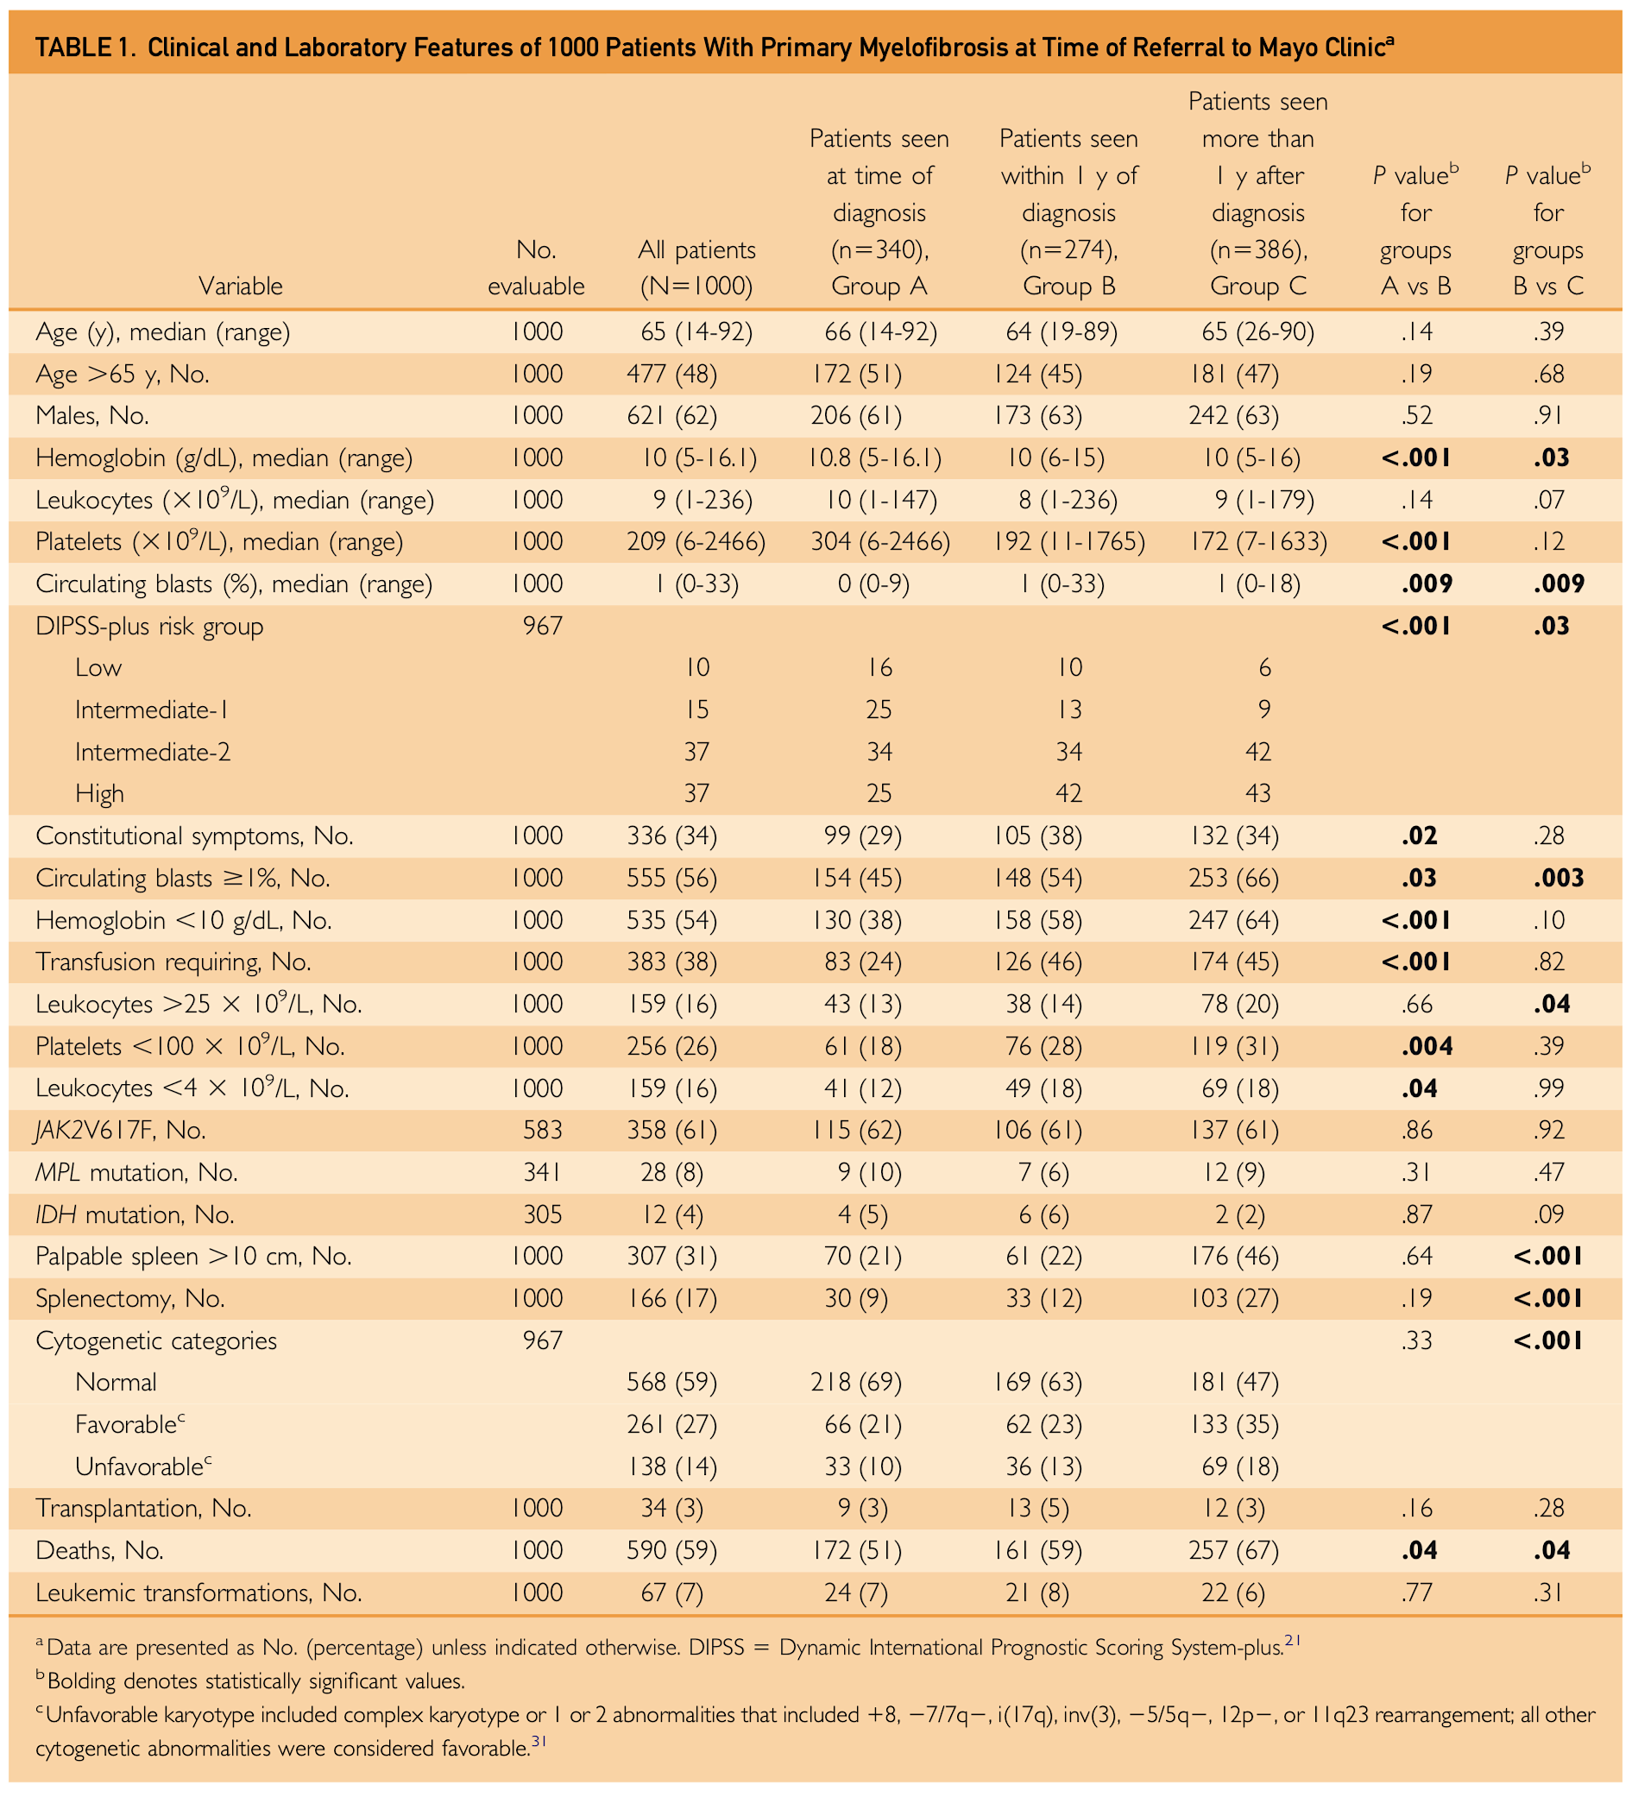
Anemia in Myelofibrosis – Defining the Scope of the Problem
Anemia is a defining feature of MF
Virtually all MF patients develop anemia at some point in their disease course
Nearly 40% of MF patients have Hgb < 10g/dL at diagnosis
Nearly 25% already transfusion-dependent at diagnosis
Anemia has a detrimental impact on quality of life for MF patients
Amelioration of anemia has been associated with improved QOL
Anemia has been consistently associated with poor prognosis in MF
Anemia remains an important unmet need for MF patients
Tefferi et al, Mayo Clinic Proc 2012

Slide 67
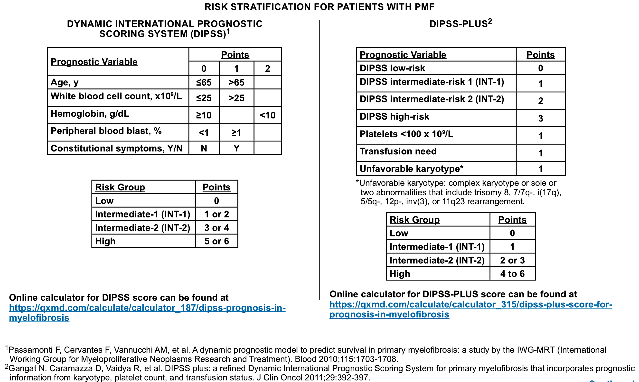
Anemia in Myelofibrosis – Defining the Scope of the Problem
NCCN guidelines for MPNs v2.2025

Slide 68
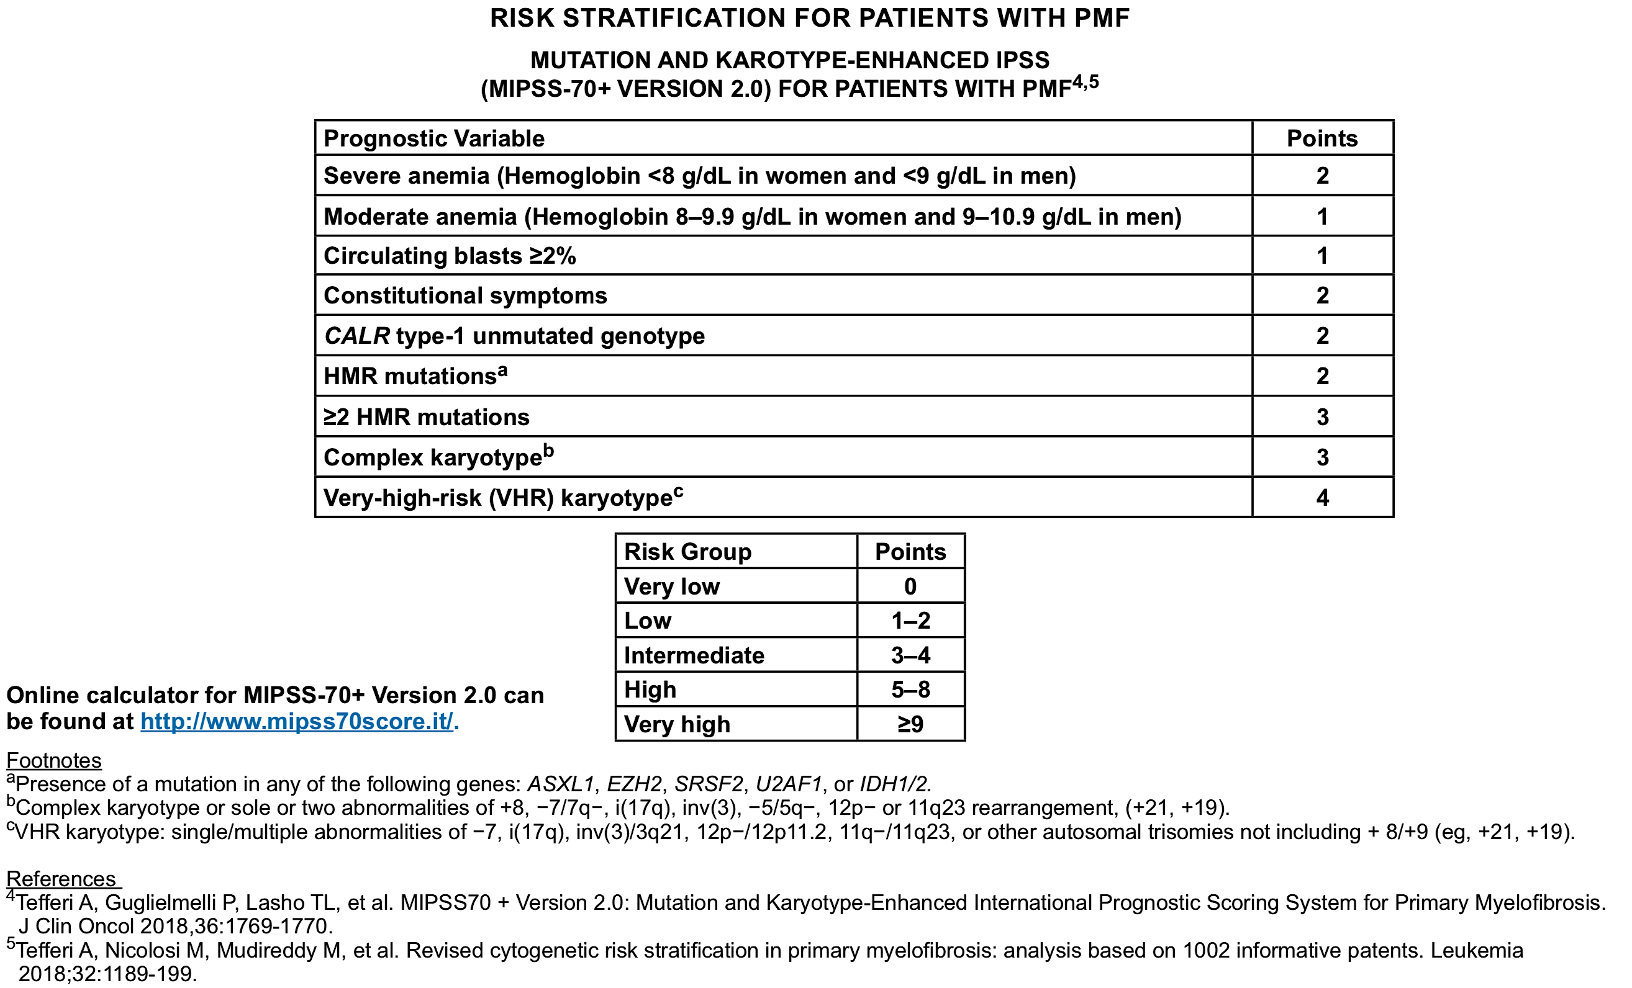
Anemia in Myelofibrosis – Defining the Scope of the Problem
MUTATION AND KARYOTYPE-ENHANCED IPSS
NCCN guidelines for MPNs v2.2025

Slide 69
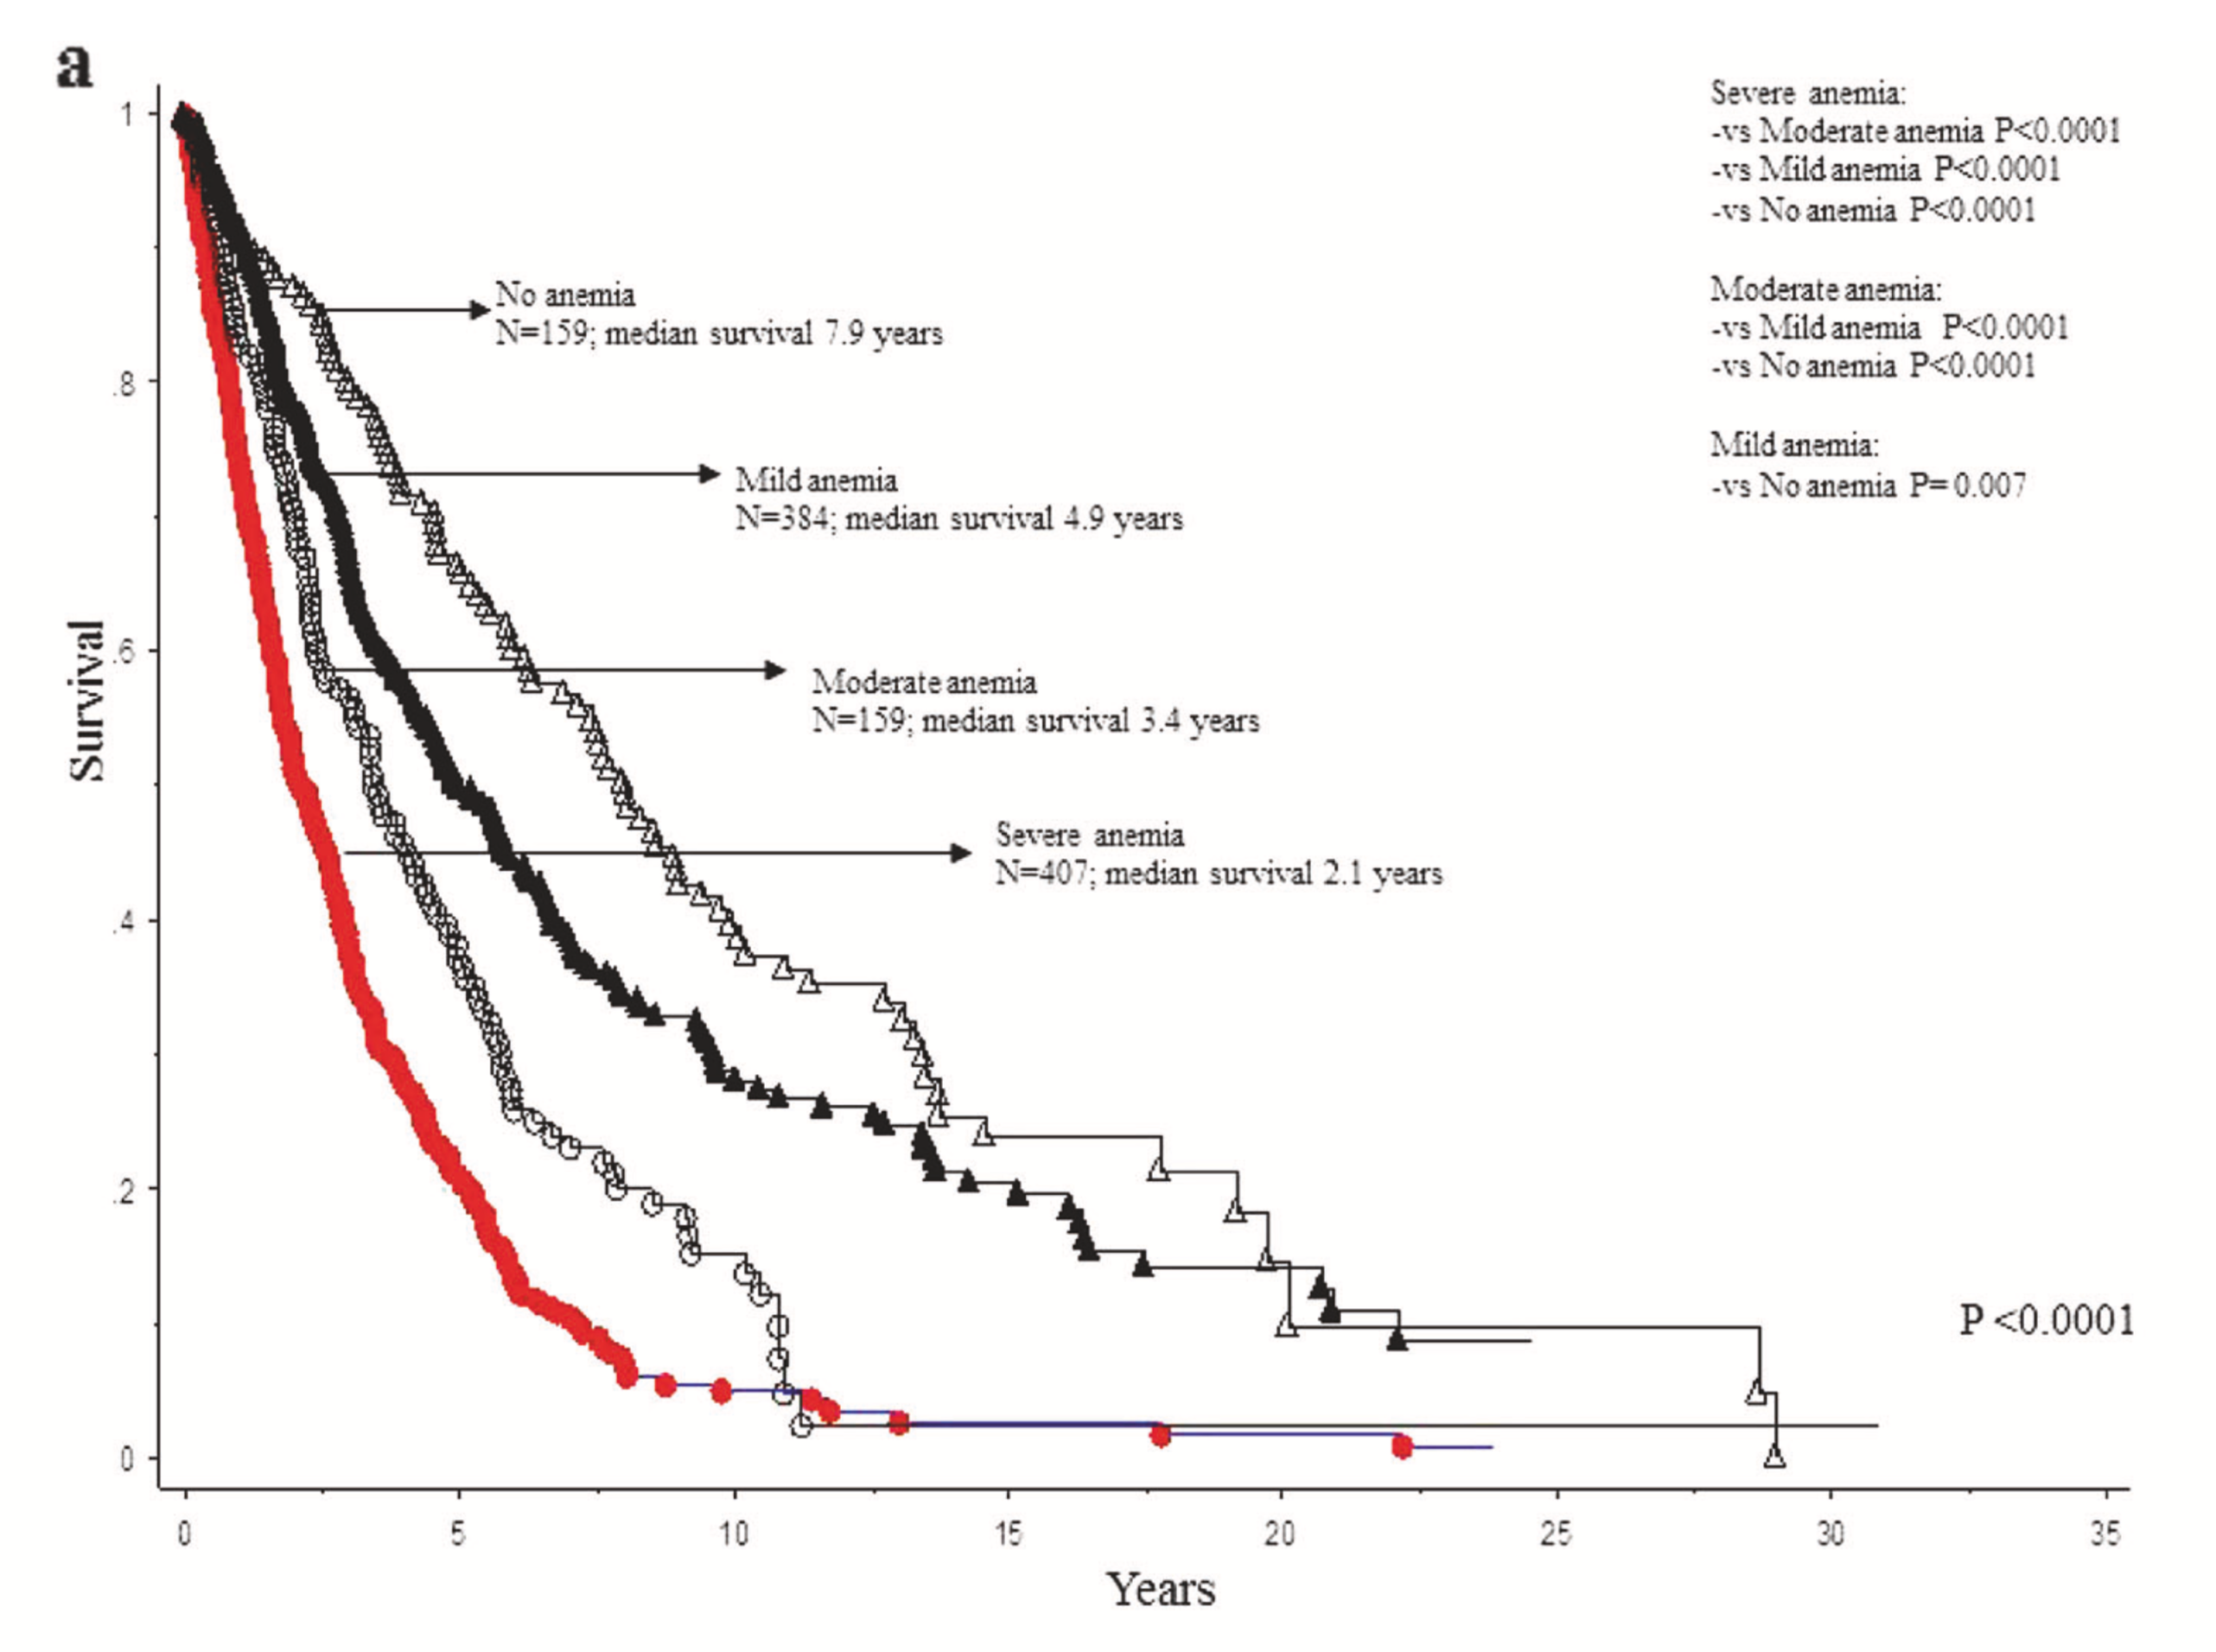
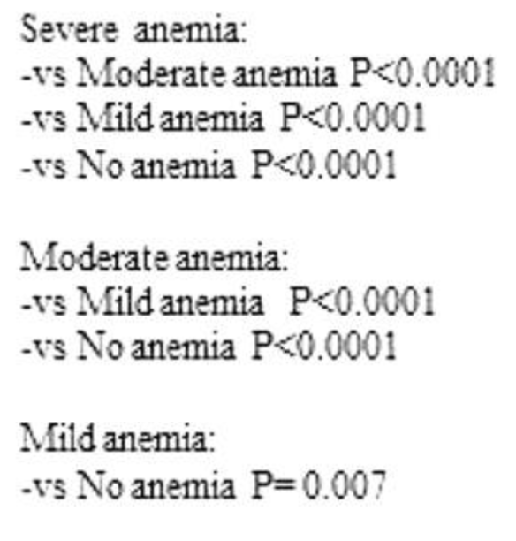
Anemia in Myelofibrosis – Defining the Scope of the Problem
Hgb > 10 g/dL but below sex-adjusted lower limit of normal
Nicolosi et al, Leukemia 2018

Slide 70
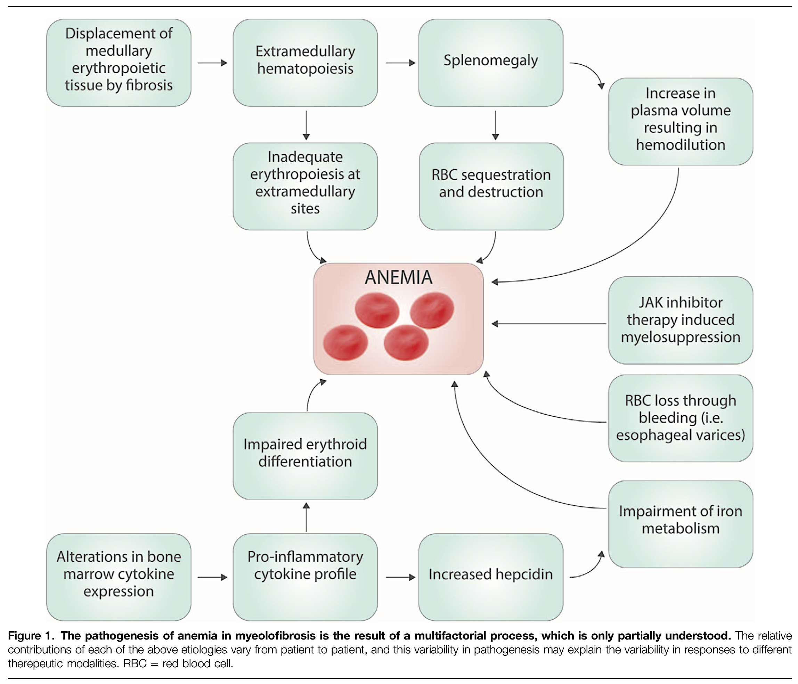
Anemia in Myelofibrosis - Pathogenesis
myelofibrosis
Naymagon & Mascarenhas, HemaSphere 2017

Slide 71
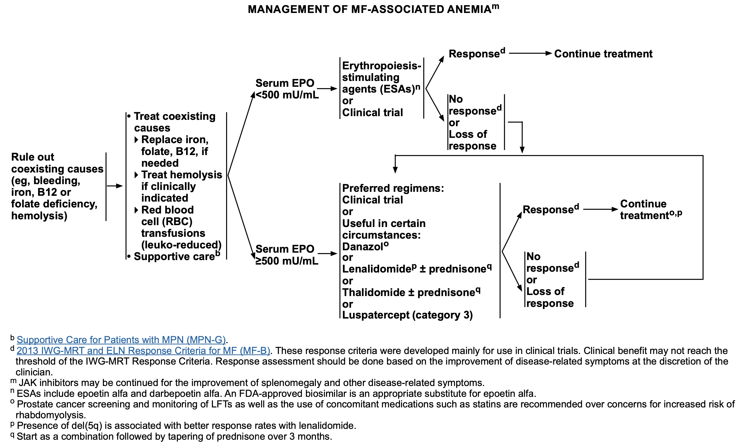
Anemia in Myelofibrosis – NCCN Guidelines
NCCN guidelines for MPNs v2.2023

Slide 72
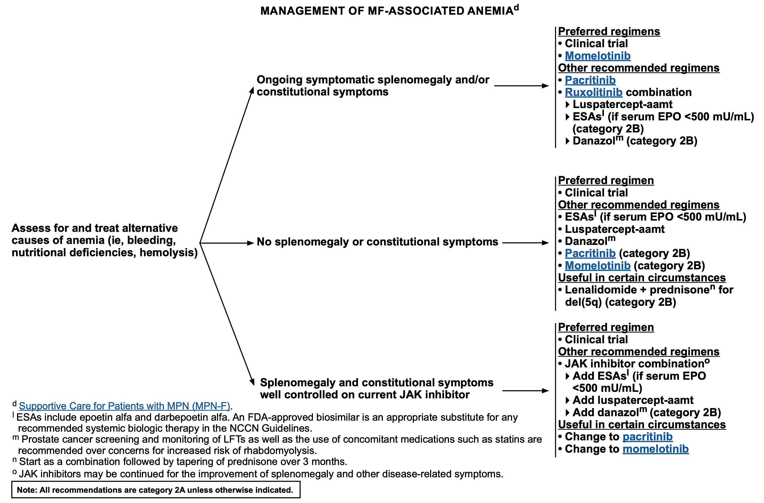
Anemia in Myelofibrosis – NCCN Guidelines
NCCN guidelines for MPNs v2.2025

Slide 73
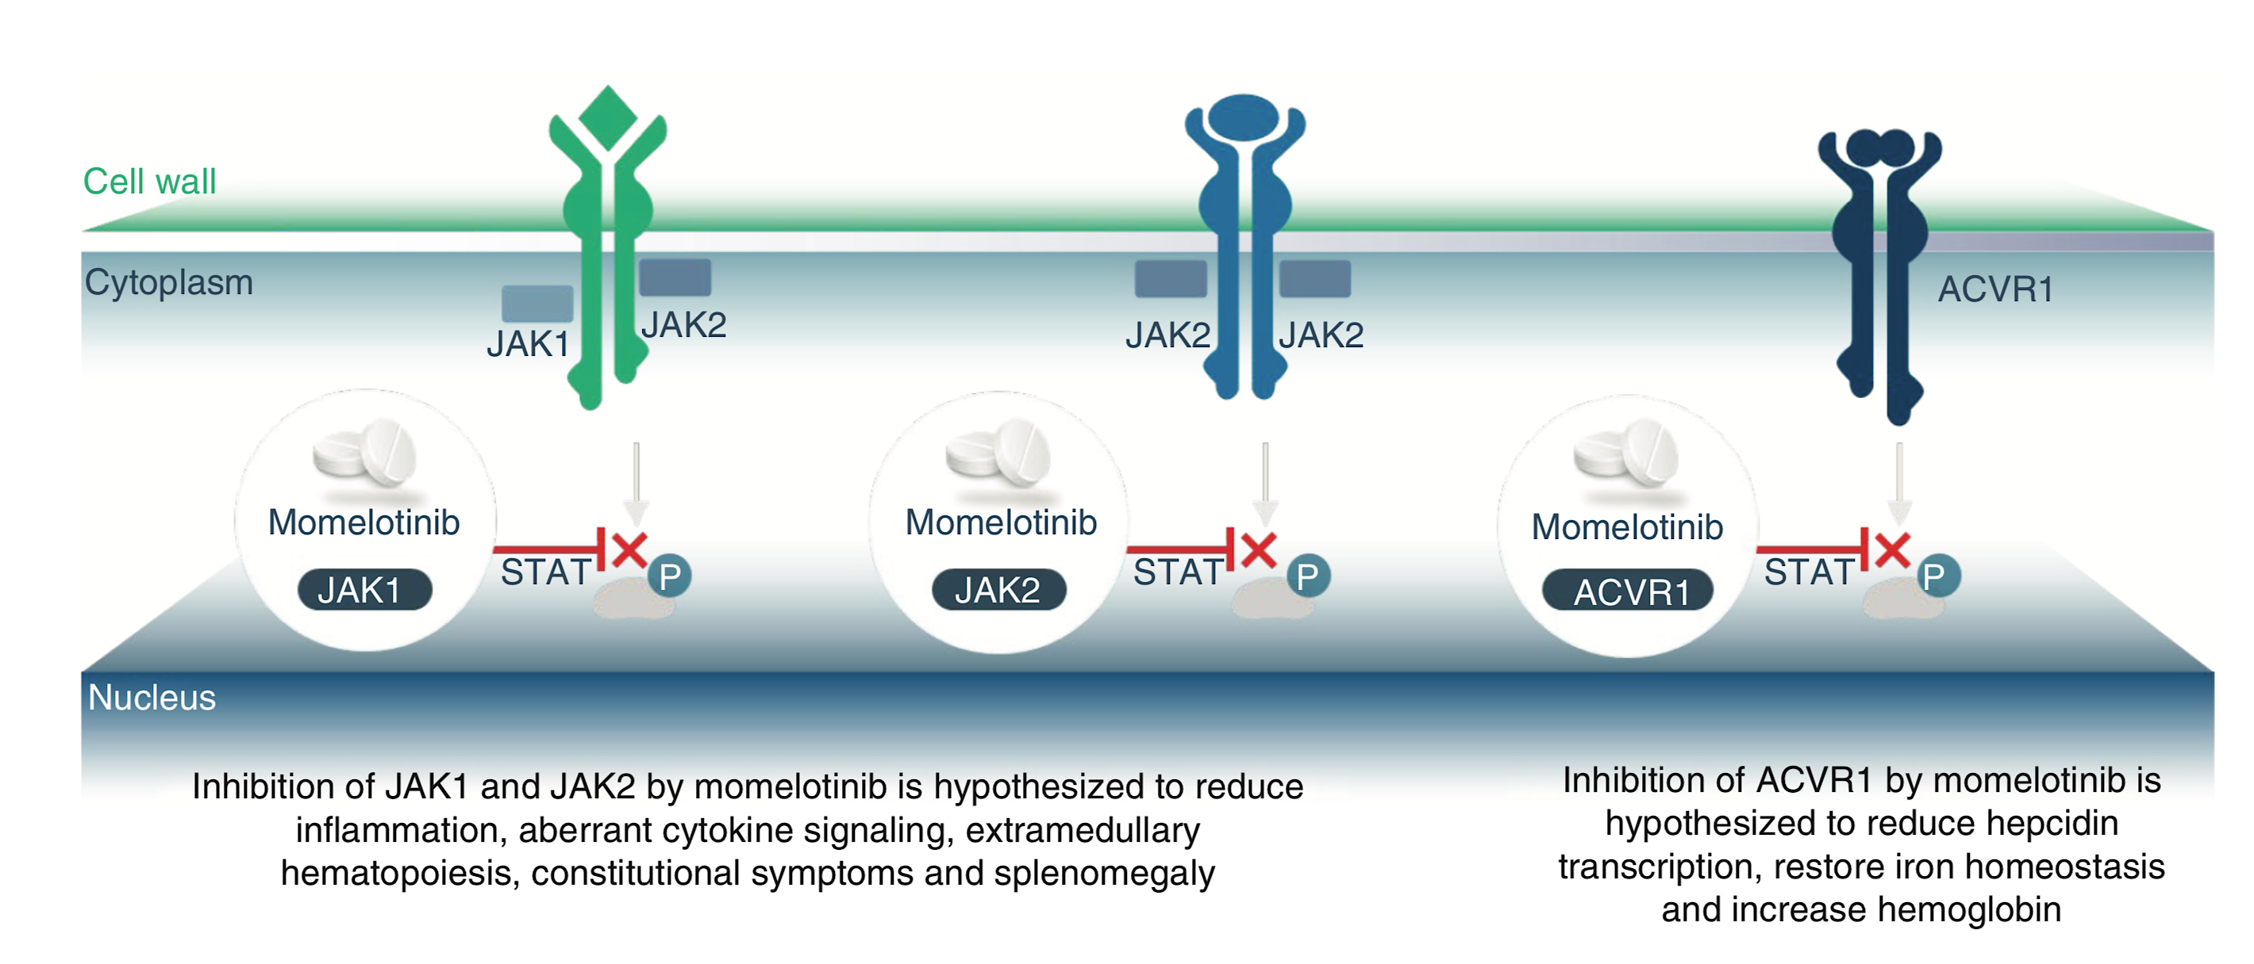
Anemia in Myelofibrosis – Momelotinib
Verstovsek et al, Future Oncol 2021

Slide 74
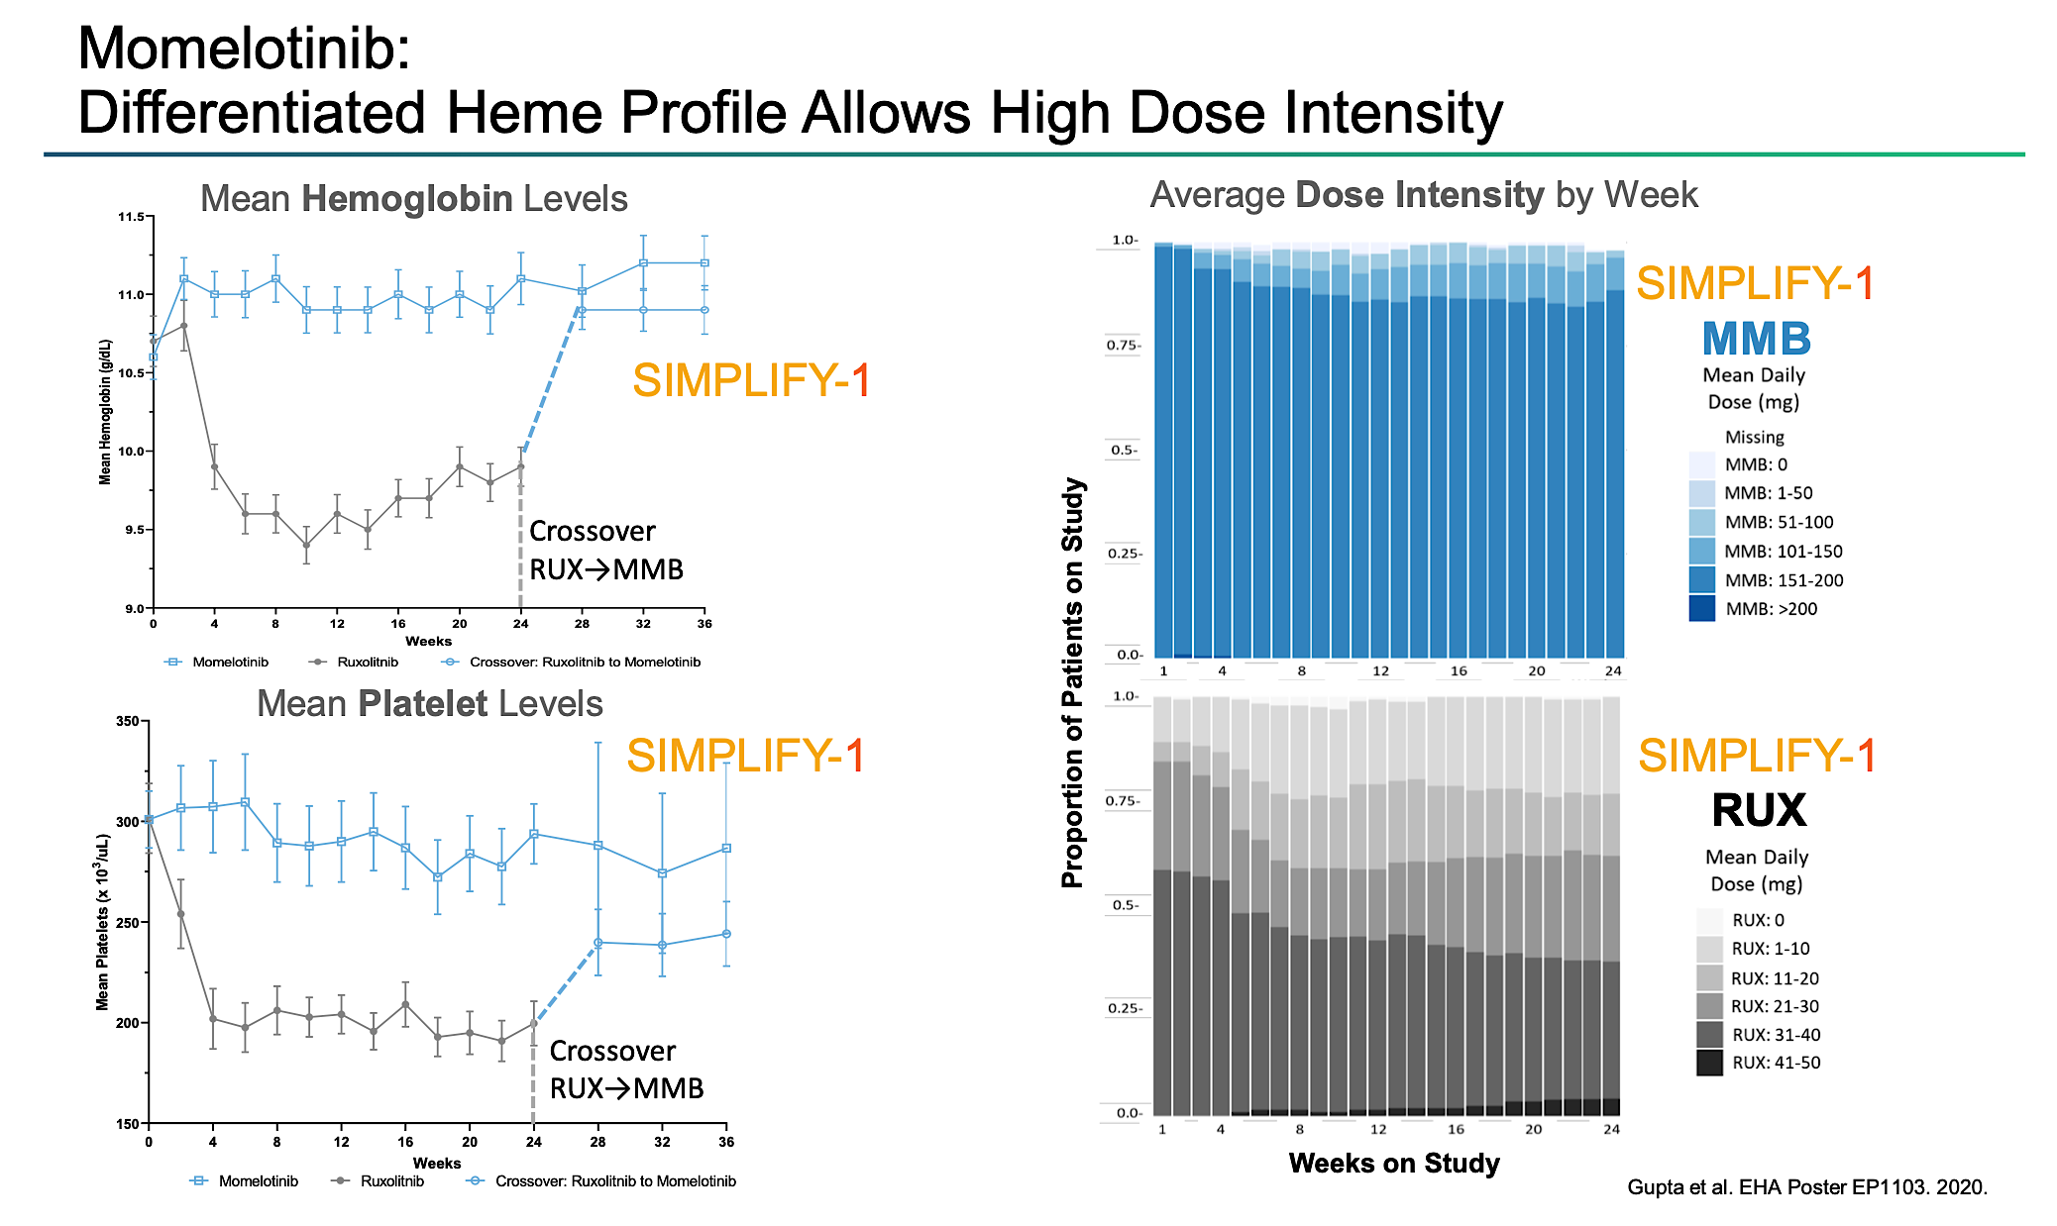
Anemia in Myelofibrosis – Momelotinib
Ruxolitinib
Ruxolitinib to Momelotinib
Ruxolitinib
Ruxolitinib to Momelotinib
Verstovsek et al, ASH 2020

Slide 75
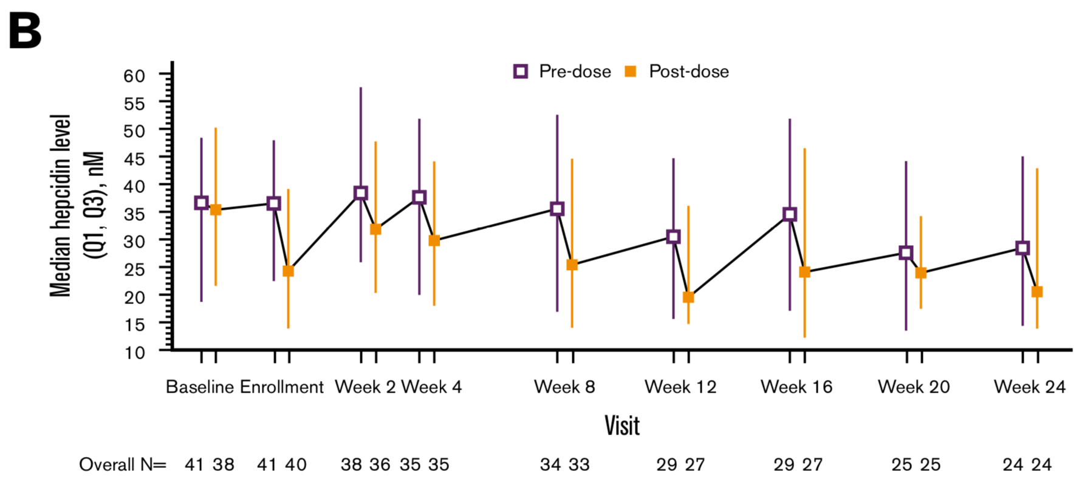
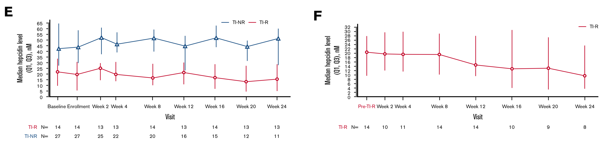
Anemia in Myelofibrosis – Momelotinib
Oh et al, Blood Advances 2020

Slide 76
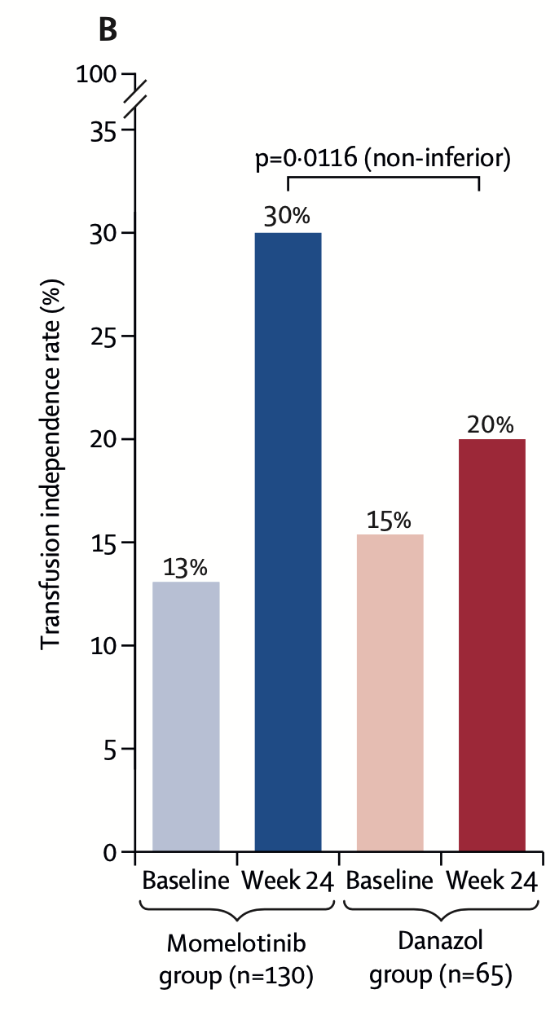
MOMENTUM Phase III Study of Momelotinib vs Danazol in Symptomatic Patients with Myelofibrosis and Anemia
Transfusion Independence at Week 24
Total Symptom Score Response Rate at Week 24
 | MFSAF TSS Response Rate at Week 24 no. (%) [95% CI] | P Value
Momelotinib (n = 130) | 32 (25) [17, 33] | .0095
Danazol (n = 65) | 6 (9) [4, 19] | 67.7
Spleen Response Rate at Week 24
 | SRR at Week 24, n (%) [95% CI]
 | 25% reduction | 35% reduction
Momelotinib (n = 130) | 52 (40) [32, 49] | 30 (23) [16, 31]
Danazol (n = 65) | 4 (6) [2, 15] | 2 (3) [1, 11]
 | P < .0001 | P = .0006
Verstovsek et al. Lancet 2023

Slide 77
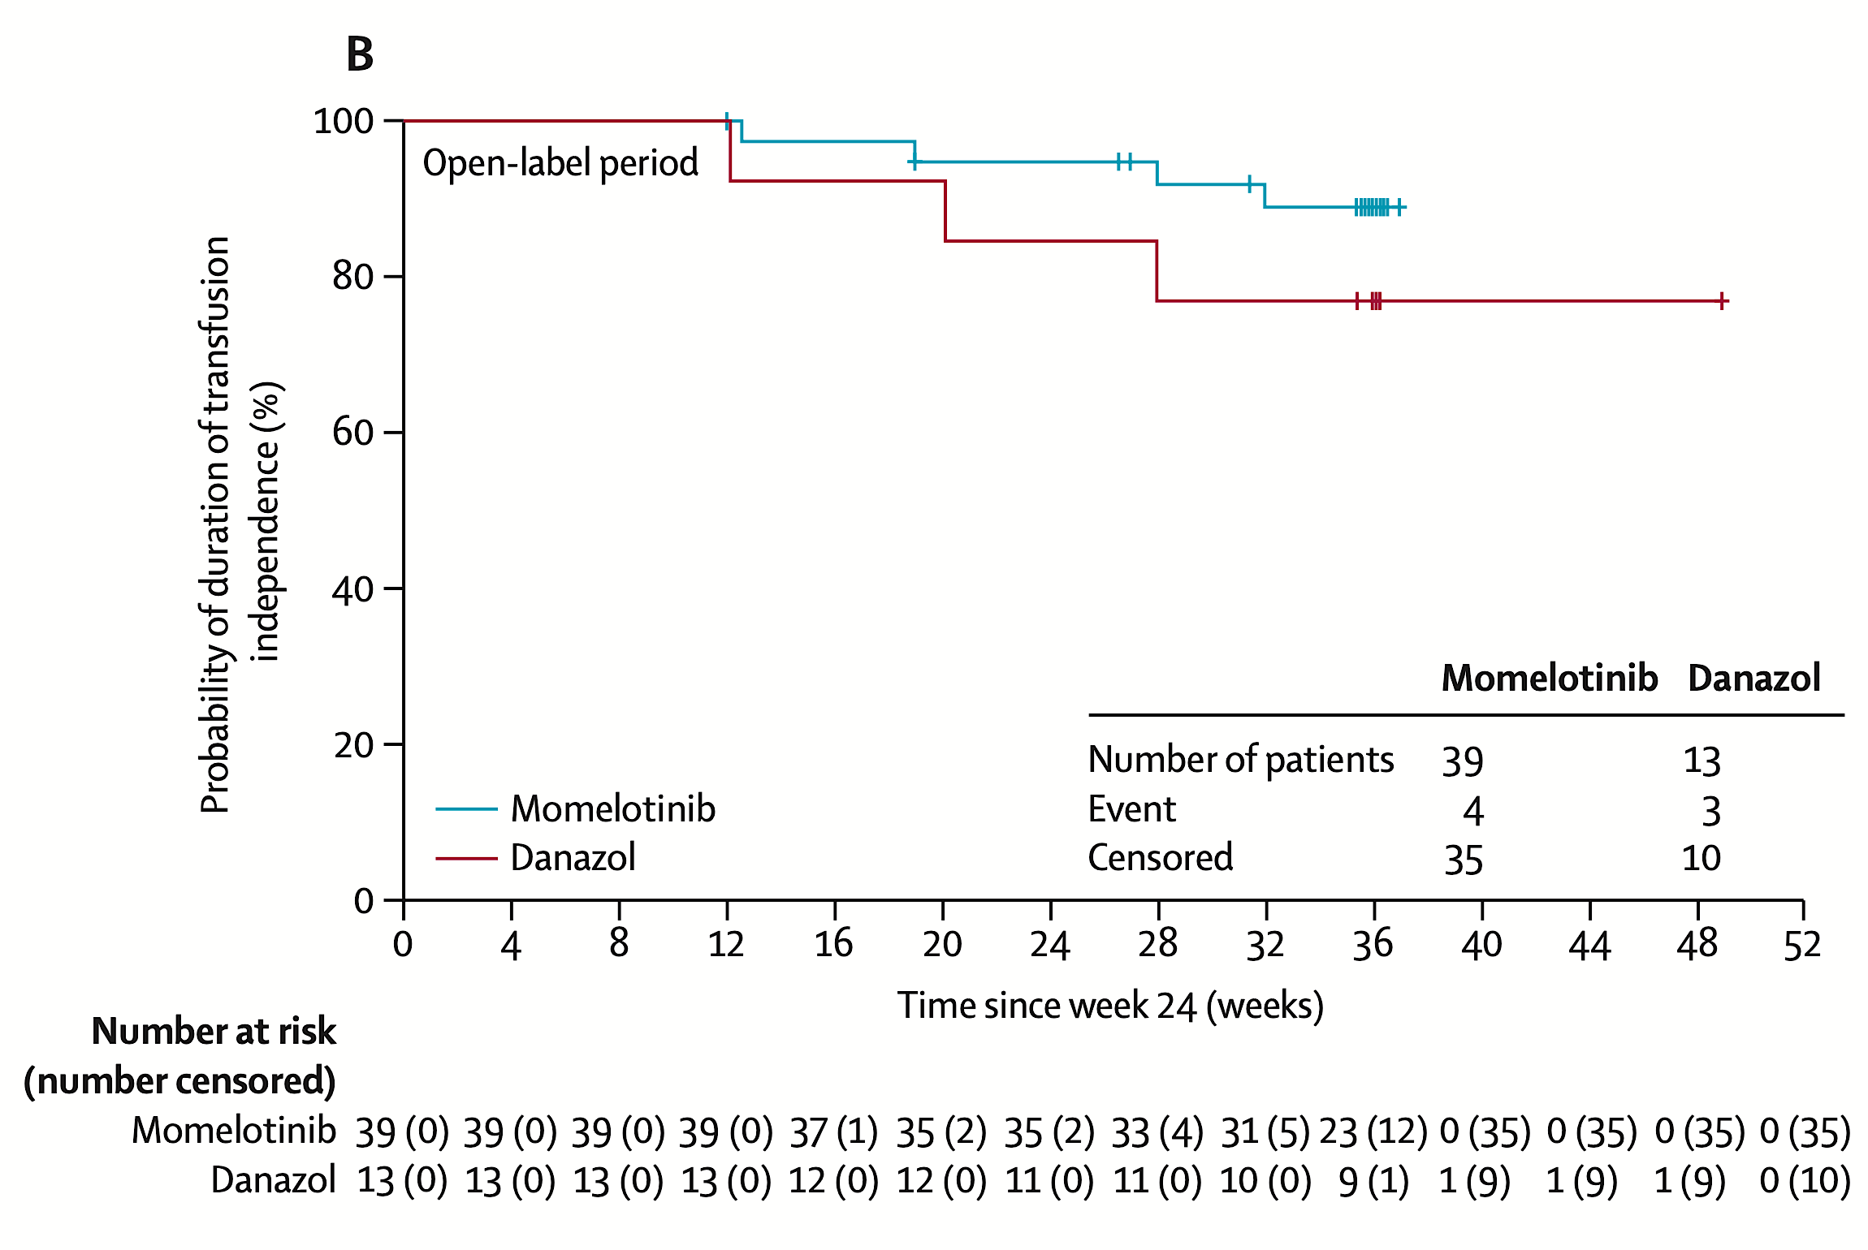
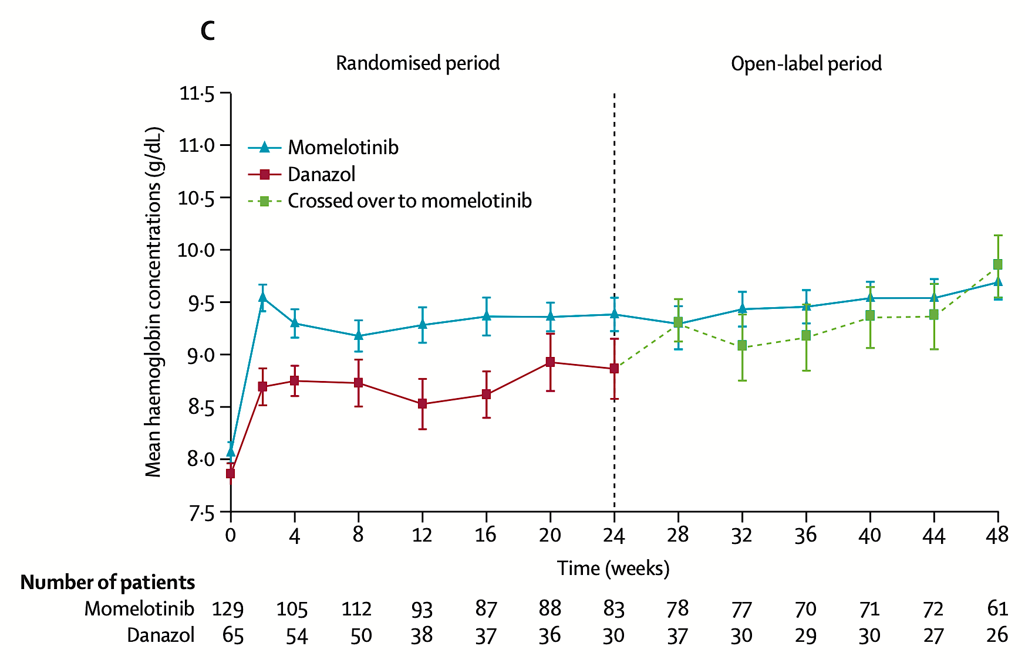
MOMENTUM: Week 24 TI Responses Sustained Through Week 48
Week 24 TI response was maintained in 35 of 39 (90%) MMB->MMB and 10 of 13 (77%) DAN->MMB patients
Gerds et al, Lancet Haematology 2023

Slide 78
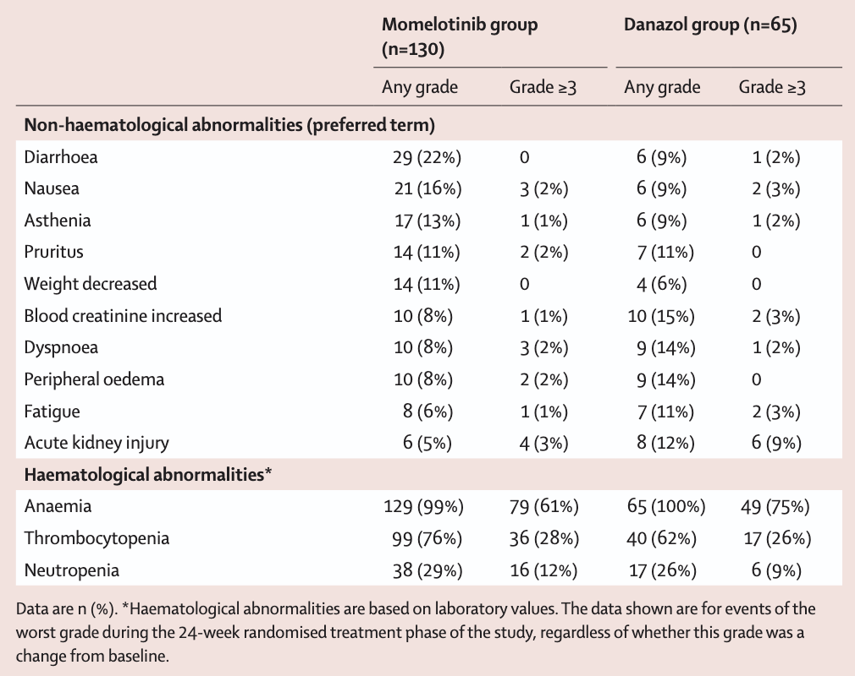
MOMENTUM: Treatment-Emergent Adverse Events (TEAEs, ≥10% of Patients)
Verstovsek et al. Lancet 2023

Slide 79
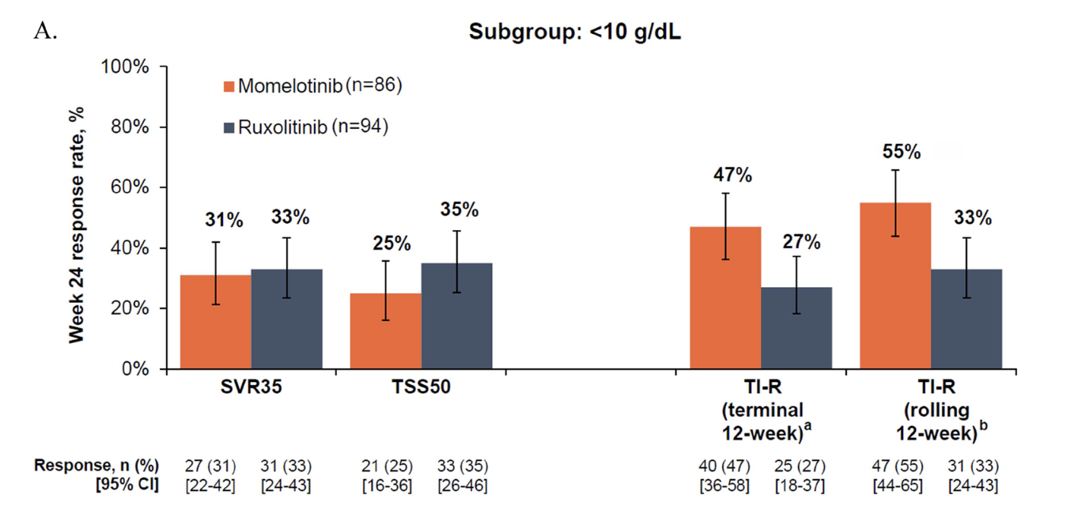
SIMPLIFY-1: Week 24 Efficacy Endpoints With Momelotinib in Subgroup of Patients with MF and Moderate/Severe Baseline Anemia
Gupta et al. Leuk Lymphoma 2024.

Slide 80
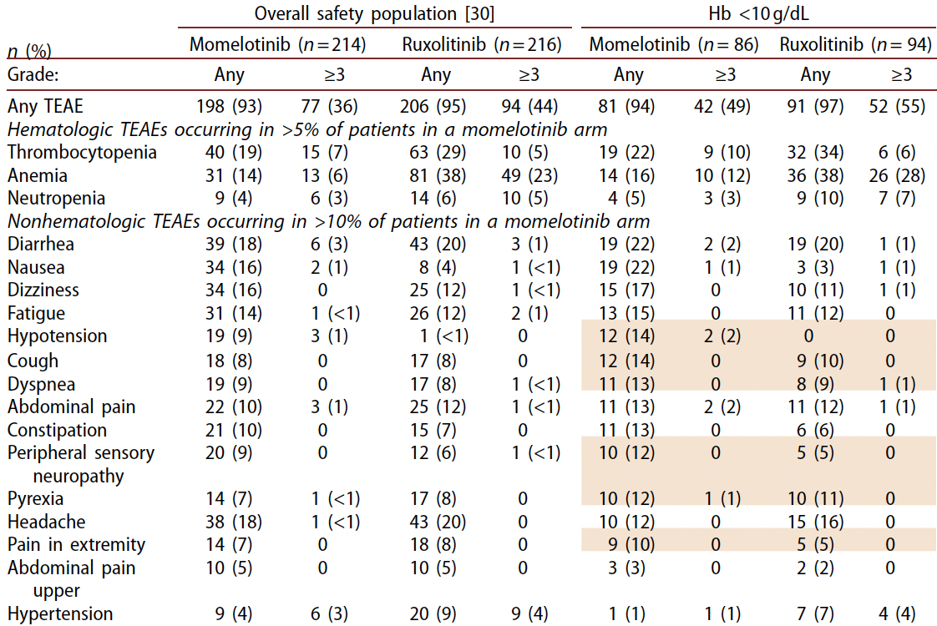
SIMPLIFY-1: Most Common TEAEs in Overall Safety Population and Moderate/Severe Baseline Anemia Subgroup
Gupta et al. Leuk Lymphoma 2024.

Slide 81
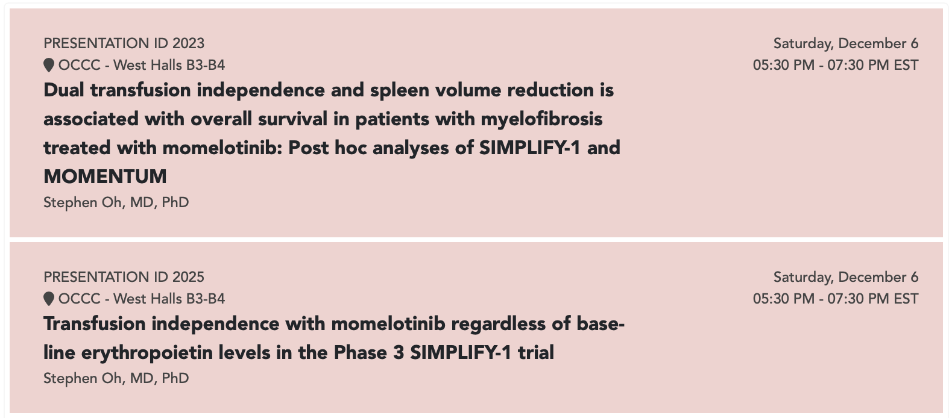
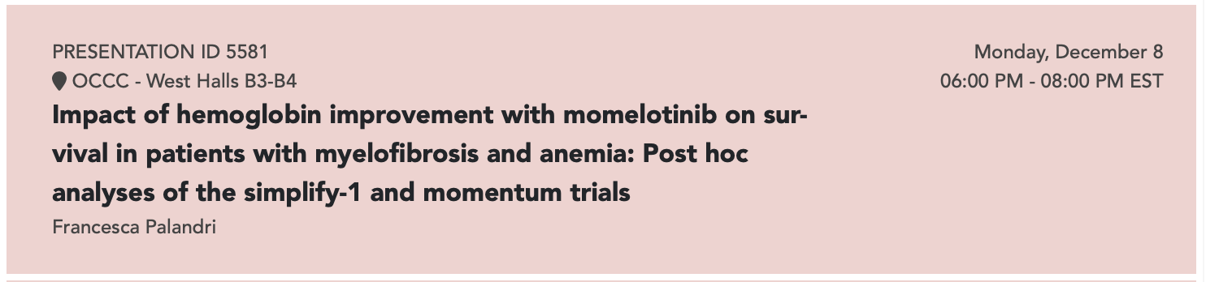
Anemia in Myelofibrosis – Momelotinib
ASH 2025

Slide 82
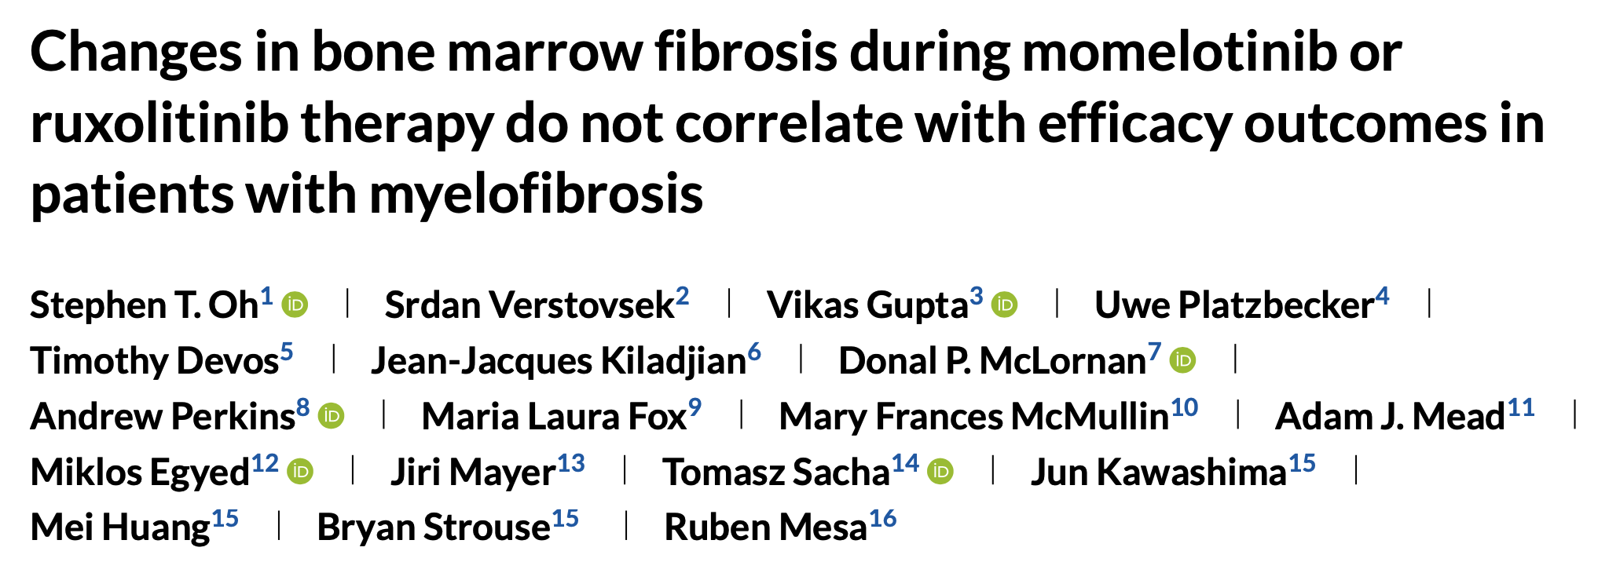
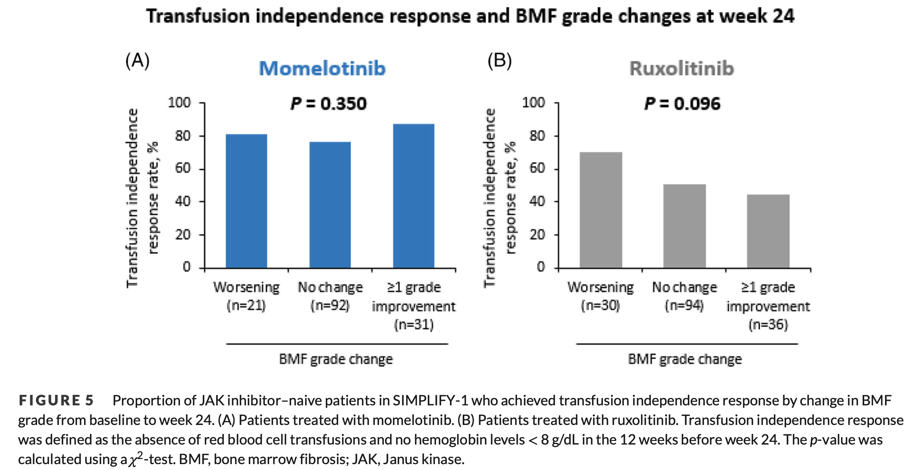
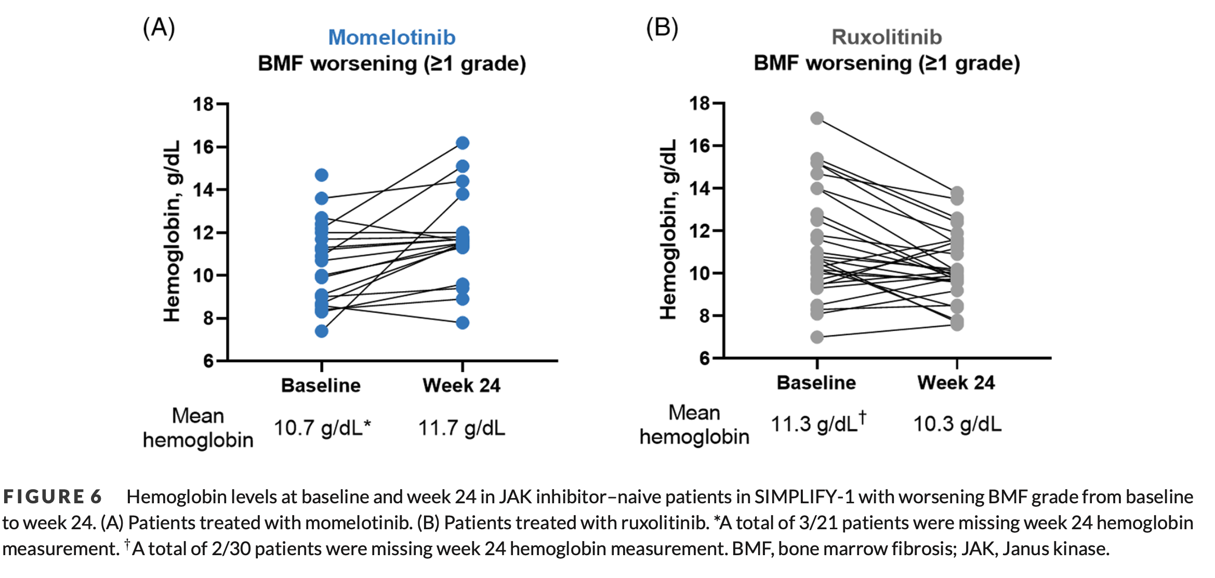
Anemia in Myelofibrosis – Momelotinib
Anemia response with momelotinib in SIMPLIFY-1 study occurred regardless of improvement or worsening in BM fibrosis
Oh et al, eJHaem 2024

Slide 83

Anemia in Myelofibrosis –Pacritinib
Pacritinib inhibits ACVR1 activity
Oh et al, Blood Advances 2024

Slide 84

Anemia in Myelofibrosis –Pacritinib
Pacritinib decreases hepcidin expression in vitro
Oh et al, Blood Advances 2023

Slide 85

Anemia in Myelofibrosis –Pacritinib
In PERSIST-2 more pacritinib patients achieved transfusion independence
Oh et al, Blood Advances 2023

Slide 86

Anemia in Myelofibrosis –Pacritinib
More pacritinib patients had ≥ 50% reduction in transfusion burden
Oh et al, Blood Advances 2023

Slide 87
Anemia in Myelofibrosis –Pacritinib
ASH 2025

Slide 88
Case Presentation: 72-year-old man with splenomegaly and mild fatigue is diagnosed with JAK2 V617F-mutant primary MF and receives momelotinib
Dr Laura Michaelis (Milwaukee, Wisconsin)

Slide 89
QUESTIONS FOR THE FACULTY
How do you select a JAK inhibitor for patients with primary MF and anemia? Are you now preferentially employing momelotinib for all patients with higher-risk MF who present with anemia?
Are there any circumstances in which you would consider momelotinib over other JAK inhibitors for a broader population, such as for patients who do not have clinically significant anemia but are refractory to initial JAK inhibitor therapy?
What leads you to include luspatercept for your patients with MF-associated anemia?

Slide 90
Post-hoc analysis from SIMPLIFY-1 (EHA)
Dr Prithviraj Bose (Houston, Texas)

Slide 91

Palandri F et al.
EHA 2025;Abstract S1829

Slide 92
QUESTIONS FOR THE FACULTY
What were your thoughts about the post-hoc analysis from SIMPLIFY-1 presented at EHA?
What is your experience with nonhematologic toxicities of momelotinib, including hypotension and neuropathy?
In what situations will you recommend momelotinib to a patient with preexisting peripheral neuropathy?

Slide 93
Agenda
Module 1: Current Clinical Decision-Making for Myelofibrosis (MF) in the Absence of Severe Cytopenias — Dr Palmer
Module 2: Managing MF in Patients with Anemia — Dr Oh
Module 3: Managing MF in Patients with Thrombocytopenia — Dr Rampal
Module 4: Promising Novel Agents Under Investigation for MF — Prof Harrison
Module 5: Current and Future Management of Systemic Mastocytosis — Dr Kuykendall

Slide 94

Management of Patients with Myelofibrosis and Thrombocytopenia
Raajit Rampal M.D. Ph.D.
Director, Center for Hematologic Malignancies
Director, Myeloproliferative Neoplasm Program

Slide 95
Case Presentation
67-year-old male presents with fatigue and abdominal fullness
Endorses early satiety
Exam: Splenomegaly (14 cm below costal margin); volume 3500cm³
CBC: WBC 8.3 x 10⁹/L (1% blasts), Hb 8.0 g/dL, platelets 41 x 10⁹/L
Bone marrow biopsy: 90% cellular marrow with myeloid expansion, dysplastic megakaryocytes in clusters, and MF-3 fibrosis with 2% myeloid blasts
Cytogenetics: Del 7q
Myeloid NGS panel: JAK2 V617F+, U2AF1+
A MUD has been identified, however transplant is felt to be too high risk due to massive splenomegaly
Notes:
To be a discussion question

Slide 96
The Spectrum of Myelofibrosis Phenotypes
Proliferative MF
Laboratory values (clinical presentation)
Cytopenic MF
Normal or elevated blood cell counts
Lower blood cell counts, increased circulating blasts
More often secondary, but can progress to cytopenic
Etiology of MF
More often primary
Often present/ higher frequency
JAK2 mutation burden
Less often present/ lower frequency; some triple negative
Less commonly present
Other myeloid mutations
Often present and may precede JAK2 mutation
Better/lower AML risk
Prognosis
Poor/higher AML risk
AML, acute myeloid leukemia.
Marcellino BK, et al. Clin Lymphoma Myeloma Leuk. 2020;20:415-421.

Slide 97
Thrombocytopenia: Incidence and Prevalence
The incidence of thrombocytopenia (PLT < 100 × 10⁹/L) is approximately 25% in patients newly diagnosed with MF^{[1]}
The prevalence of thrombocytopenia (PLT < 100 × 10⁹/L) is approximately 68% in all patients diagnosed with MF^{[2]}
1. Masarova L, et al. Eur J Haematol. 2018;100:257-263; 2. Masarova L, et al. Leuk Res. 2020;91:106338.
Notes:
From 338434-02
Timecode: 16:36
From 318348.01
Masarova L, et al. Significance of thrombocytopenia in patients with primary and post-essential thrombocythemia/polycythemia vera myelofibrosis. Eur J Haematol. 2018;100:257-263
Masarova L, et al. Severe thrombocytopenia in myelofibrosis is more prevalent than previously reported. Leuk Res. 2020;91:106338.

Slide 98

Thrombocytopenia is Prognostic of Inferior Outcomes
OS of patients with PLT < 100 × 10⁹/L is worse than those with PLT > 100 × 10⁹/L^{[1]}
In patients with PLT < 50 × 10⁹/L
2× higher risk of leukemia^{[1]}
High-grade marrow fibrosis^{[2]}
More anemia and leukopenia^{[2]}
PLT (× 10⁹/L) | < 100 | > 100 | P value
Median OS (mo) | 26 | 57 | < .001
[1]
OS 15 mo
Typical Characteristics of Patients with PLT < 50 × 10⁹/L:^{[3]}
Older
Anemic
Transfusion- dependent
Leukopenic
PB blasts
Adverse karyotype
BMF score = 3
Primarily PMF; less PET/PPV MF
BMF, bone marrow fibrosis; PB, peripheral blood.
1. Masarova L, et al. Eur J Haematol. 2018;100:257-263; 2. Masarova L, et al. Leuk Res. 2020;91:106338; 3. Alhuraiji A, et al. J Clin Oncol. 2016;34(suppl 15):7068.
Notes:
From 338434-02
Timecode: 17:12
From 318348.01

Slide 99

Thrombocytopenia is Associated with Worse Symptom Burden
Significant:
Brief Fatigue Index
Worst fatigue
Early satiety
Inactivity
Dizziness
Sad mood
Cough
Night sweats
Itching
Fever
Weight loss
Overall QoL
10.0
PLT count > 100 × 10⁹/L
PLT count ≤ 100 × 10⁹/L
9.0
* P < .05
**P < .001
8.0
7.0
6.0
Symptom Severity
*
5.0
*
**
**
4.0
*
**
*
*
**
3.0
*
2.0
*
1.0
*
0.0
Brief Fatigue Index
Worst fatigue
Early satiety
Abdominal pain
Abdominal discomfort
Inactivity
Headache
Poor concentration
Dizziness
Numbness
Insomnia
Sad mood
Sexual dysfunction
Cough
Night sweats
Itching
Bone pain
Fever
Weight loss
Overall QoL
QoL, quality of life. Scotch AH, et al. Leuk Res. 2017;63:34-40.
Notes:
From 338434-02
Timecode: 19:16
From 318348.01
Scotch AH, et al. Symptom burden profile in myelofibrosis patients with thrombocytopenia: lessons and unmet needs. Leuk Res. 2017;63:34-40.

Slide 100
Thrombocytopenia and Anemia Often Co-Occur
Variable | PLT < 50 × 10⁹/L, % (n = 57) | PLT > 50 × 10⁹/L, % (n = 834) | P Value
Age > 65 y | 75 | 60 | .019
Bleeding manifestations | 19 | 6 | < .001
Constitutional symptoms | 40 | 34 | .31
Hgb < 80 g/L | 35 | 8 | < .001
WBC count < 4 × 109/L | 26 | 10 | < .001
WBC count > 25 × 109/L | 14 | 11 | .47
Blasts ≥ 1% | 57 | 45 | .069
Blasts ≥ 3% | 21 | 11 | .022
Grade 3 BMF | 24 | 11 | .008
Unfavorable cytogenetics | 17 | 11 | .35
JAK2 mutated | 50 | 64 | .057
Int-2/high-risk IPSS | 86 | 60 | < .001
Int-2/high-risk DIPSS+ | 100 | 59 | < .001
WBC, white blood cell Modified from Hernandez-Boluda JC, et al. Brit J Haem. 2018;181:397-400.
Notes:
From 338434-02
Timecode: 20:29
Comments: This source is under the author Jonassaint in RC. I was unable to correct this.
From 318348.01
Hernandez-Boluda JC, et al. Clinical characteristics, prognosis and treatment of myelofibrosis patients with severe thrombocytopenia. Brit J Haem. 2018;181:386-417.
Hernández-Boluda JC, Correa JG, Alvarez-Larrán A, Ferrer-Marín F, Raya JM, Martínez-López J, Velez P, Pérez-Encinas M, Estrada N, García-Gutiérrez V, Fox ML, Luño E, Kerguelen A, Cuevas B, Durán MA, Ramírez MJ, Gómez-Casares M, Mata-Vázquez MI, Regadera A, Pereira A, Cervantes F; Grupo Español de Enfermedades Mieloproliferativas Filadelfia Negativas (GEMFIN). Clinical characteristics, prognosis and treatment of myelofibrosis patients with severe thrombocytopenia. Br J Haematol. 2018 May;181(3):397-400. doi: 10.1111/bjh.14601. Epub 2017 Apr 17. PMID: 28419426.

Slide 101
Current JAK Inhibitor Landscape
JAKi | Ruxolitinib | Fedratinib | Pacritinib | Momelotinib
Targets | JAK1, JAK2 | JAK2, JAK1 (less), FLT3, TYK2, many others | JAK2, IRAK1, FLT3, ACVR1 | JAK1, JAK2, ACVR1
Indication | Intermed or high-risk MF with platelets ≥50k | Intermed-2 or high-risk MF with platelets ≥50k | Intermed or high-risk MF with platelets <50k | Approved for MF patients with Anemia
Clinical practice points | Hematologic toxicities | Hematologic toxicities GI toxicities Monitor thiamine | Less cytopenia-inducing GI toxicities Monitor QTc Monitor for bleeding | Less cytopenia-inducing Rare peripheral neuropathy
Verstovsek et al NEJM 2012, Pardanani et al. JAMA Oncology 2015, Mascarenhas et al. JAMA Oncology 2018, Verstovsek et al Lancet 2023

Slide 102

Pacritinib
Pacritinib is an oral kinase inhibitor approved in 2022 for intermediate-risk or high-risk PMF or secondary MF with PLT < 50 × 10⁹/L
Pacritinib does not inhibit JAK1 and has higher inhibitory activity for JAK2 than JAK3/TYK2, which minimizes exacerbation of thrombocytopenia
Most frequent nonhematologic AEs: diarrhea, nausea, and peripheral edema
Pacritinib
1. Pacritinib [PI]. Approved 2022. Revised August 2023; 2. Mesa RA, et al. Lancet Haematol. 2017;4:e225-e236; 3. Mascarenhas J, et al. JAMA Oncol. 2018;4:652-659; 4. Singer JW, et al. J Exp Pharmacol. 2016;8:11-19.
Notes:
Updated from 342509-02
From 324565.01
References: From 316301.01 slide 35. Table on right: Singer table 1 and table 2 (for JAK1 info only); Singer JW, Al-Fayoumi S, Ma H, Komrokji RS, Mesa R, Verstovsek S. Comprehensive kinase profile of pacritinib, a nonmyelosuppressive Janus kinase 2 inhibitor. J Exp Pharmacol. 2016 Aug 16;8:11-9. Mascarenhas J, Talpaz M, Gupta V, et al. Primary analysis of a phase II open-label trial of INCB039110, a selective JAK1 inhibitor, in patients with myelofibrosis. Haematologica 2017; 102(2):327.

Slide 103
Pacritinib: Phase 3 Trial PERSIST-2 Pacritinib 400 mg QD or 200 mg BID vs BAT (Including JAK1/2 Inhibitors) in MF¹
In this phase 3 trial, 200 mg BID was also tested for potentially improved tolerability, given PK modeling data demonstrating increased daily systemic exposure with lower maximum concentration vs 400 mg QD²
Key Eligibility Criteria
PMF, PET-MF, PPV-MF
Intermediate- or high-risk disease
Moderate-to-severe thrombocytopenia at baseline (≤100x10⁹/L)
No exclusion for Hgb levels or RBC-TD
Prior JAK1/2 inhibitors allowed
1:1:1 Randomization
N=311
Stratification at randomization
Rebound platelet countª
DIPSS risk category
Geographic region
Pacritinib
400 mg QD
Coprimary endpoints
Pooled pacritinib arms vs BAT
SVR ≥35% by MRI/CT
≥50% reduction in TSS^{c} ITT-efficacy population,^{d} baseline to week 24
Pacritinib
200 mg BID
BAT^{b}; including JAK1/2 inhibitors
~40% of patients had baseline PLT < 50K
1. Mascarenhas J, et al. JAMA Oncol. 2018;4:652-659. 2. Al-Fayoumi S, et al. Blood. 2013;122;4080.

Slide 104
PERSIST-2: Baseline Characteristics and BAT Received
Key Baseline Characteristics in ITT-Efficacy Population^{1,2} | PAC 200 mg BID (n = 74) | BAT (n = 72)
Median age, years ≥65 years, % | 67 62 | 69 71
Male, % | 65 | 54
MF diagnosis: PMF, PPV-MF, PET-MF, % | 74, 19, 7 | 60, 22, 18
DIPSS scoreª: Int-1, Int-2, High, % | 19, 51, 30 | 18, 51, 31
Median spleen length, cmª | 15 | 13
JAK2^{V617F} positive, % | 80 | 71
JAK2^{V617F} allele burden, median | 30 | 25
Platelet count <50 × 10⁹/L, % | 42 | 44
Hemoglobin <10 g/dL, % | 59 | 57
RBC transfusion dependence^{b}: dependent, independent, indeterminate, % | 19, 50, 30 | 19, 51, 29
Prior JAK1/2 inhibitors, % Prior ruxolitinib | 45 42 | 47 46
Of the BAT patients who received ruxolitinib, 93% began treatment at ≤10 mg BID, including 64% at ≤5 mg BID³
BAT Received in >2 Patients, %¹ | BAT (n = 98)
Ruxolitinib^{c} | 45
Hydroxyurea | 19
Watch-and-wait only | 19
Prednisone/prednisolone | 13
Danazol | 5
Thalidomide | 3
Note: While allowed on the BAT arm, patients who received pacritinib could not receive corticosteroids or erythropoietic agents.²
ªBy physician examination. ^{b}Defined according to Gale criteria; missing for 1 PAC patient. ^{c}Seventeen (39%) had baseline platelet counts <50 × 10⁹/L and would not have been candidates for ruxolitinib by approved indication (or PERSIST-2 study protocol). BAT, best available therapy; BID, twice daily; DIPSS, Dynamic International Prognostic Scoring System; Int, intermediate; ITT, intention-to-treat; JAK, Janus kinase; MF, myelofibrosis; PAC, pacritinib; PET-MF, postessential thrombocythemia MF; PMF, primary MF; PPV-MF, postpolycythemia vera MF; RBC, red blood cell. 1. Mascarenhas J, et al. JAMA Oncol. 2018;4:652-659; 2. Data on File. CTI Biopharma Corp. PERSIST-2 CSR; 3. Harrison C, et al. EHA 2017. Abstract P701.

Slide 105
PERSIST-2: Spleen/Symptom Response
ITT Population
Patients With Platelets <50x10⁹/L
SVR ≥35%¹
≥50% reduction in modified TSS^{2,a}
SVR ≥35%¹
≥50% reduction in modified TSS^{2,a}
Week 24
P=0.004
Week 24
P=0.001
The proportions of patients with much improved or very much improved scores were 57% with pacritinib 200 mg BID versus 28% with BAT
ª Excludes individual symptom score for tiredness from MPN-SAF TSS v2.0; utilized in pivotal trials for other JAK inhibitors.
BAT, best available therapy; BID, twice daily; ITT, intention-to-treat; MPN-SAF, myeloproliferative symptom assessment form; PAC, pacritinib; SVR, spleen volume reduction; TSS, total symptom score.
1. Mascarenhas J, et al. JAMA Oncol. 2018;4:652-659. 2. Data on File. CTI Biopharma Corp. Pacritinib Clinical Overview.
Notes:
Patient Global Impression of Change (PGIC)
By PGIC scoring, patients in the pacritinib 200 mg BID vs BAT arms were more likely to self-score as “much improved” or “very much improved” (57% vs 28%)
Additional modified TSS results
Median percent changes in modified TSS were larger in the pacritinib 200 mg BID vs BAT arms
Overall: -44% vs -15%
Patients with <50x10⁹/L platelets: -37% vs -2%
Greater improvements in individual MPN-SAF TSS v2.0 symptoms scores seen across all symptoms with pacritinib 200 mg BID vs BAT
References
Mascarenhas J, et al. JAMA Oncol. 2018;4(5):652-659.
Data on File. CTI Biopharma Corp. Pacritinib Clinical Overview.

Slide 106
PERSIST-2: Hematologic Stability
Clinical Improvement in Hemoglobin Levels
in Patients With Baseline Anemiaª
Pacritinib Reduced Transfusion Burden in Patients Not TI at Baseline
Transfusion Burden in Patients Who Received ≥1 RBC Transfusion on Study
Baseline to week 24
Baseline to week 24
Units per month
Pacritinib (200mg BID)
BAT
TI defined according to Gale criteria (0 units over the course of 12 weeks).
ªInternational Working Group response criteria: increase of ≥2.0 g/dL or RBC transfusion independence for ≥8 weeks prior; anemia defined as hemoglobin <10 g/dL.
BAT, best available therapy; BID, twice daily; ITT, intention-to-treat; PAC, pacritinib; RBC, red blood cell.
Mascarenhas J, et al. JAMA Oncol. 2018;4:652-659.

Slide 107
PERSIST-2: Adverse Event Profile
Adverse Reactions | PAC 200 mg BID (n = 106) | BAT (n = 98)
Any-grade AEs in >15% of patients in either arm, %
Diarrhea | 48 | 15
Thrombocytopenia | 34 | 24
Nausea | 32 | 11
Anemia | 24 | 15
Peripheral edema | 20 | 15
Vomiting | 19 | 5
Fatigue | 17 | 16
Grade ≥3 AEs in >5% of patients in either arm, %
Thrombocytopenia | 32 | 18
Anemia | 22 | 14
Neutropenia | 7 | 5
Pneumonia | 7 | 3
Serious AEs in >3% of patients in either arm, %
Anemia | 8 | 3
Thrombocytopenia | 6 | 2
Pneumonia | 6 | 4
Congestive heart failure | 4 | 2
Diarrhea with pacritinib most often occurred during weeks 1–8, was manageable, and resolved within 1–2 weeks
Neurologic AEs and opportunistic infections rarely reported with pacritinib
Grade ≥3 Events (Pooledª)
Safety outcomes with pacritinib were similar for those with <50 × 10⁹/L vs 50–100 × 10⁹/L platelets at baseline
ªPooled, per standardized MedDRA queries.
AE, adverse event; BAT, best available therapy; BID, twice daily; PAC, pacritinib.
Mascarenhas J, et al. JAMA Oncol. 2018;4:652-659.

Slide 108




Response to Pacritinib is Associated with an Overall Survival Benefit
PAC 200 mg BID: survival stratified by SVR
OS stratified by ≥20% SVR
OS stratified by ≥10% SVR
P =0.0199
P <0.0001
BAT: survival stratified by SVR
OS stratified by ≥20% SVR
OS stratified by ≥10% SVR
P =0.9821
P =0.4888
Ajufo, et al. European Journal of Haematology 2024
Notes:
Compared to SVR ≥10% responders, non-responders had smaller spleen volumes and were more likely to require RBC transfusions at baseline.
"We found that spleen volume reduction was associated with survival benefit on pacritinib-treated patients. This slide shows survival based on different SVR thresholds, from 35% reduction on the left to 10% reduction on the right. Of all tested SVR thresholds, the 10% threshold showed the greatest separation in survival curves between responders and non-responders, with the majority of patients achieving response. SVR thresholds of both 20% and 0% were also found to be prognostic, but the separation of curves was not as great as with the 10% cut-off."
"The median dose intensity of pacritinib was 100% among both SVR-10 responders and non-responders, meaning that most patients were receiving a full 200mg BID dose through the time of their SVR assessment."
"Interestingly, spleen length reduction by palpation was also associated with survival, particularly among patients who achieved a 20% or greater reduction in palpable spleen length. However, spleen palpation was less prognostic than spleen volume by imaging in predicting survival."

Slide 109


Response to Pacritinib is Associated with an Overall Survival Benefit
Ajufo, et al. European Journal of Haematology 2024

Slide 110
Pacritinib: Phase II Dose-Finding Study PAC203 in Patients With MF Intolerant of or Resistant to Ruxolitinib
PAC203 incorporated risk-mitigation factors put in place to address findings from the thorough clinical review of PERSIST data, including enhanced eligibility criteria, patient monitoring, and dose modifications
Pacritinib
100 mg QD
Key Eligibility Criteria
PMF, PET-MF, PPV-MF
DIPSS intermediate- or high-risk disease
Ruxolitinib intolerant for ≥28 daysª or resistance for ≥3 months^{b}
1:1:1
Randomization
N = 161
Stratification at randomization
Platelet count
Geographic region
Primary endpoint
Confirm/Determine recommended dose
Secondary endpoints
Dose-response for efficacy (SVR, reduction in TSS) and safety
PK/PD determination
Pacritinib
100 mg BID
Pacritinib
200 mg BID
ªComplicated by red blood cell transfusion, grade ≥3 anemia, thrombocytopenia, hematoma, and/or hemorrhage while treated with a dosage of <20 mg twice daily. ^{b}Less than 10% SVR or <30% decrease in spleen length or regrowth of these parameters.
BID, twice daily; DIPSS, Dynamic International Prognostic Scoring System; MF, myelofibrosis; PET-MF, postessential thrombocythemia MF; PK/PD, pharmacokinetic/pharmacodynamic; PMF, primary MF; PPV-MF, postpolycythemia vera MF; QD, once daily; SVR, spleen volume reduction; TSS, total symptom score.
Gerds AT, et al. Blood Adv. 2020;4:5825-5835.

Slide 111
PAC203: Baseline Characteristics
Key Baseline Characteristics | PAC 100 mg QD (n = 52) | PAC 100 mg BID (n = 55) | PAC 200 mg BID (n = 54)
Median age, years | 69.5 | 69.0 | 68.5
Male, % | 60 | 53 | 59
MF diagnosis: PMF, PPV-MF, PET-MF, % | 54, 31, 15 | 51, 33, 16 | 69, 19, 13
DIPSS score: Int-1, Int-2, High, % | 17, 48, 35 | 26, 49, 26 | 22, 52, 26
Median spleen length, cm | 12 | 15 | 14
Median platelet count, × 10⁹/L <50 × 10⁹/L, % | 59 44 | 53 44 | 59 44
Platelet transfusion-dependent,ª % | 12 | 9 | 11
Hemoglobin <10 g/dL, % | 67 | 69 | 76
RBC transfusion dependence^{b}: dependent, independent, indeterminate, % | 29, 46, 25 | 27, 42, 29 | 39, 37, 24
Prior ruxolitinib: resistant, intolerant, both, % | 77, 73, 50 | 75, 75, 51 | 78, 70, 48
Median duration of prior ruxolitinib, years | 1.7 | 1.8 | 1.6
Of note, patients were required to taper ruxolitinib to ≤10 mg BID during screening, but no treatment washout was required
Baseline analyses of spleen size and symptoms may have occurred while patients were still receiving ruxolitinib
Potential impact on reductions measured on study
ªDefined by any platelet transfusion required during the past month. ^{b} Defined by Gale criteria.
BID, twice daily; DIPSS, Dynamic International Prognostic Scoring System; Int, intermediate; MF, myelofibrosis; PET-MF, postessential thrombocythemia MF; PMF, primary MF; PPV-MF, postpolycythemia vera MF; QD, once daily; PAC, pacritinib; RBC, red blood cell.
Gerds AT, et al. Blood Adv. 2020;4:5825-5835.

Slide 112


PAC203: Spleen Response Across Doses (Evaluable Population, Week 24)
<50x10⁹/L
≥50x10⁹/L
Evaluable SVR in patients with severe thrombocytopenia (<50 × 10⁹/L) at baseline treated with 200 mg BID
31%
BID, twice daily; QD, once daily; SVR, spleen volume reduction.
Gerds AT, et al. Blood Adv. 2020;4:5825-5835.

Slide 113

PAC203: Symptom Responses Across Doses (Evaluable Population, Week 24)
TSS analyzed as a continuous variable:
Deeper reductions with 200 mg BID
Note: One patient with 302% increase from baseline TSS score represented by truncated bar to fit to scale (far right bar in 100 mg BID).
BID, twice daily; QD, once daily; TSS, total symptom score.
Gerds AT, et al. Blood Adv. 2020;4:5825-5835.

Slide 114


PAC203: Hematologic Stability
Platelet counts were stable for most patients on study, including those with severe thrombocytopenia
Reductions in transfusion burden and achievement of transfusion independence occurred in patients in all arms
Percentage Change in Platelet Count From Baseline
Hgb Increases in Patients With Baseline Anemia (Hgb ≤10 g/dL)
LARGER INCREASES IN Hgb IN MORE PATIENTS AT 200 MG BID
Baseline to week 24
BID, twice daily; Hgb, hemoglobin; IQR, interquartile range; PAC, pacritinib; QD, once daily.
Gerds AT, et al. Blood Adv. 2020;4:5825-5835.

Slide 115
PAC203: Adverse Event Profile
Adverse Reactions | PAC 100 mg QD (n = 52) | PAC 100 mg BID (n = 55) | PAC 200 mg BID (n = 54)
Grade ≥3 AEs in >5% of patients in any arm, %
Thrombocytopenia | 19 | 22 | 33
Anemia | 10 | 7 | 20
Pneumonia | 4 | 4 | 9
Neutropenia | 6 | 6 | 6
Diarrhea | 2 | 4 | 6
Fatigue | 6 | 4 | 4
Abdominal pain | 0 | 4 | 6
Hyperuricemia | 2 | 2 | 6
Hyponatremia | 0 | 6 | 4
Dehydration | 0 | 6 | 2
Hypertension | 0 | 6 | 2
Grade ≥3 Events (Pooledª)
Two deaths due to bleeding events, subdural hemorrhages, at 100 mg BID and 200 mg BID
One death due to cardiac event, heart failure in the setting of progressive hyperleukocytosis, at 100 mg BID
No patient had QTc >500 msec
Rates of bleeding and cardiac events were generally lower than those reported in PERSIST-2,² likely due to enhanced patient selection, patient monitoring, and dose-modification guidelines
ªPooled, per standardized MedDRA queries.
AE, adverse event; BID, twice daily; PAC, pacritinib; QD, once daily.
1. Gerds AT, et al. Blood Adv. 2020;4:5825-5835; 2. Mascarenhas J, et al. JAMA Oncol. 2018;4(5):652-659.

Slide 116



ASH 2023
non-responders,
19% of pacritinib treated patients on PAC203 and PERSIST-2 trials experienced an improvement in platelet counts

Slide 117
PACIFICA: A Randomized, Controlled Phase 3 Study of Pacritinib Versus Physician's Choice in Patients with Primary or Secondary Myelofibrosis and Severe Thrombocytopenia
Key Eligibility Criteria:
PMF, PET-MF, PPV-MF
DIPSS Intermediate- or high-risk disease
Severe thrombocytopenia at baseline (<50 x 10⁹/L)
JAK2 inhibitor-naïve or limited duration of prior JAK2 inhibitor
2:1 Randomization N=399
Stratification at randomization:
Prior JAK2 inhibitor therapy
Physician’s choice selected prior to randomization
Pacritinib
200 mg BID
Co-primary endpoints at 24 weeks:
Reduction in SVR ≥35%
Reduction in mTSS ≥50%
Key secondary endpoints
PGIC at 24 weeks
Overall survival
Safety
Physician’s Choice
Low-dose ruxolitinib (5 mg QD or BID)
Hydroxyurea
Danazol
Corticosteroids
Investigators can select an individual P/C agent but cannot combine agents or give them sequentially.
Patients are treated until disease progression, intolerable adverse events, or withdrawal of consent.
All patients are followed for survival until 2.5 years after randomization.
Notes:
The PACIFICA phase 3 trial is designed to evaluate efficacy and safety of pacritinib 200 mg twice daily vs physician's choice therapy in patients with myelofibrosis and severe thrombocytopenia.

Slide 118
MOMENTUM: A Phase 3 Study of Momelotinib Versus DAN in Symptomatic, Anemic, JAKi-Experienced Patients
Double-blind treatment
Open-label crossover
Long-term follow-up
Previously treated with JAKi Symptomatic (TSS ≥10)
Anemic (Hgb <10 g/dL)
Platelets ≥25×10⁹/L
Patients
N=195
MMB 200 mg daily
+ PBO
MMB
200 mg daily
Early crossover if confirmed progression
2:1 randomization
DANª 600 mg daily
+ PBO
JAKi taper/washout ≥21 days
Stratification:
TSS
Palpable spleen length
Transfused units in prior 8 weeks
Study site
Planned enrollment: 180
FPE Apr 2020
LPE Jun 2021
Database lock Dec 2021
Primary end point
Day 1
Week 24
MOMENTUM Topline Results at Week 24: All Primary and Key Secondary End Points Met^{1,2}
 | MFSAF TSS^{b} response rate (primary end point) | TI response^{c} rate | SRR^{d} (35% reduction)
MMB (N=130) | 32 (24.6%) | 40 (30.8%) | 30 (23.1%)
DAN (N=65) | 6 (9.2%) | 13 (20.0%) | 2 (3.1%)
 | P=.0095 (superior) | 1-sided P=.0064 (noninferior) | P=.0006 (superior)
Mesa ASCO 2022

Slide 119
Summary
Myelofibrosis associated with cytopenias represent a significant clinical challenge
Pacritinib can be used without platelet count restrictions in patients with thrombocytopenia
Anemia, which often co-occurs with thrombocytopenia, can improve with pacritinib
Common side effects include: diarrhea (often transient), nausea, anemia, thrombocytopenia.
Momelotinib can be used in patients with a platelet count as low as 25K

Slide 120
Management of MF with moderate thrombocytopenia (75,000)
Dr Laura Michaelis
(Milwaukee, Wisconsin)
Case Presentation: 65-year-old man with primary MF and anemia (Hgb 8.2g/dL), thrombocytopenia (platelets 55,000) and splenomegaly and low JAK2 V617F allele frequency
Dr John Mascarenhas
(New York, New York)

Slide 121
QUESTIONS FOR THE FACULTY
What is your usual up-front JAK inhibitor for a patient with a platelet count of 75,000 without anemia?
Would you likely have administered pacritinib to Dr Mascarenhas’s patient?

Slide 122
Agenda
Module 1: Current Clinical Decision-Making for Myelofibrosis (MF) in the Absence of Severe Cytopenias — Dr Palmer
Module 2: Managing MF in Patients with Anemia — Dr Oh
Module 3: Managing MF in Patients with Thrombocytopenia — Dr Rampal
Module 4: Promising Novel Agents Under Investigation for MF — Prof Harrison
Module 5: Current and Future Management of Systemic Mastocytosis — Dr Kuykendall

Slide 123
Promising Novel Agents
Under Investigation for MF
Professor Claire Harrison

Slide 124


Anemia in myelofibrosis
Is an ongoing area of unmet need
And often multifactorial

Slide 125

Targets of interest for anemia in MF

Slide 126



Luspatercept
Modified from Fenaux P et al. Blood. 2019 Feb 21;133(8):790-794.

Slide 127

Anemia response rate in the Phase II ACE-536-001MF study
RBC, red blood cell; RUX, ruxolitinib; TD, transfusion dependent.​
Adapted from Gerds, et al Blood Adv. 2024;8(17):4511-4522.

Slide 128


Emerging outcomes from and potential implications of the Phase III INDEPENDENCE study evaluating luspatercept with concomitant JAK inhibitor therapy

Slide 129
Momelotinib and luspatercept have a complementary mechanism of action, which may improve anemia by promoting both early- and late-stage erythropoiesis, suggesting a potential additive and possibly synergistic benefit. The phase II ODYSSEY trial (NCT06517875) assesses this.
Cohort 1:
JAKi naïve
200mg momelotinib PO QD
1 mg/kg luspatercept SC Q3W
Screening:
(28 days)
Transfusion-dependent primary or secondary MF
Platelet count ≥50 × 10⁹/L
n = ~56
Safety Follow-up
(42 days after last study treatment)
Treatment: 24 weeks
Cohort 2:
JAKi experienced
200mg momelotinib PO QD
1 mg/kg luspatercept SC Q3W
Study is currently recruiting
Preliminary experience from the ODYSSEY trial: Efficacy and safety of momelotinib in combination with luspatercept in patients with transfusion-dependent myelofibrosis
Bose P et al. ASH 2025;Abstract 3803
Bose P et al. ASH 2024;Abstract 3191.2.

Slide 130
A retrospective study to assess real-world treatment patterns and outcomes in
luspatercept-treated patients with myelofibrosis-associated anemia who required red blood cell
transfusion in the United States
Hobbs G et al. ASH 2025;Abstract 2825
RESULTS:
At the end of data availability (Dec 31, 2024), 99 patients who received luspatercept were identified, of whom 19 also received overlapping JAKi treatment. The median (range) age was 77 years (55–87), 54.6% were male, and 41.4% had primary MF. The majority (74.7%) of patients were White, 14.1% were Black, 3.0% were Asian, and 8.1% were classified as other races. The median (IQR) time between MF diagnosis and index date was 1.2 years (0.4–3.7) and median (IQR) follow-up time post-index was 12.3 months (6.7–20.7). Thirty-one (31.3%) patients were treated with JAKi at any time post-MF diagnosis and 54 (54.6%) patients were deceased by the end of data availability. Median (IQR) number of RBCT events was 3 (2–5) and 77 (77.8%) patients were considered transfusion dependent (TD: ≥ 2 RBCT events) at baseline.
The median time to treatment discontinuation per Kaplan–Meier estimate was 33.6 weeks (95% CI 25.1– 51.7). The probability of remaining on treatment was 55.7% at 6 months and 35.8% at 12 months.
The proportion of patients who achieved RBC-TI 12 and RBC-TI 16 after luspatercept initiation was 38.4% (n = 38) and 33.3% (n = 33). The median (95% CI) duration of both RBC-TI 12 and RBC-TI 16 was 37.4 weeks (30.4–NR). Sixty-six (66.7%) patients achieved ≥ 50% RBCT reduction by 24 weeks.
CONCLUSION:
In this RW study, MF patients who required RBCT treated with luspatercept showed clinically meaningful benefits: nearly 40% achieved 12-week RBC-TI and two-thirds experienced ≥ 50% RBCT reduction within 24 weeks of luspatercept initiation. The findings of this RW study generally corroborate and supplement previous clinical trial results, indicating that luspatercept can be effective in increasing RBC-TI and reducing transfusion burden in this population.

Slide 131

Elritercept (KER-050) is Designed to Target Disorders of Ineffective Hematopoiesis Including MF
Elritercept
Activins A+B
Designed to inhibit select TGF-beta superfamily ligands, including activin A, which has been associated with ineffective hematopoiesis, inflammation, disease pathogenesis, and progression^{1,2,3}
Preclinical data showed that the research form of elritercept (RKER-050):
induced erythropoiesis in mouse model of MF⁴
reversed ruxolitinib-associated reductions in hemoglobin, hematocrit, and red blood cell (RBC) count⁵
increased platelet counts⁶
Updated results from the ongoing open-label Phase 2 RESTORE trial evaluating elritercept in participants with MF and anemia
In mono and combo spleen symptoms and anemia responses were seen
¹Verma A, et al. J Clin Inv. 2020; ²Portale F, et al. Haematologica. 2019; ³ Phillips D, et al. Cytokine Growth Factor Rev. 2009; ⁴Moses B, et al. EHA. 2023; ⁵Nathan R, et al. ASH. 2021; ⁶Moses B, et al. GRC: Cell Biology of Megakaryocytes and Platelets. 2023.
TGF-β = transforming growth factor-β.

Slide 132

Phase II RESTORE Study Design
Hematological and clinical improvements with elritercept (KER-050, TAK-226) at the recommended Phase 2 dose (RP2D)
in patients with myelofibrosis (MF) receiving ruxolitinib: Updated results from the Phase 2 RESTORE trial
Rinaldi C et al. ASH 2025;Abstract 909.

Slide 133

Spleen symptoms and biological – mutation VAF, BM fibrosis responses
In the monotherapy second line BOREAS study
NO APPARENT selection of p53 clones
? The NEXT approved therapy
Mascarenhas et al. ASH 2024;Abstract 1000

Slide 134






Slide 135

Navtemadlin in JAKi R/R MF some key biological results... Driver Gene VAF Reduction Correlates with PFS and OS in All Cohorts

Slide 136

Currently open first line study:
Mascarenhas et al. ASH 2024;Abstract 1000

Slide 137




BET Proteins Promote Myelofibrosis
INFLAMMATION
Myelofibrosis
EXTRA-MEDULLARY HEMATOPOIESIS
BONE MARROW
FIBROSIS
Increased Cytokine
Production
BET and NF-κB
Target Genes
BET
Aberrant Erythroid
Differentiation
BET
BET
Target Genes
Nucleus
Aberrant Megakaryocytic Differentiation

Slide 138

Durable efficacy and long-term safety with pelabresib plus ruxolitinib in JAK Inhibitor– Naive myelofibrosis: 96-week Results from the Phase III MANIFEST-2 study
Rampal R et al. ASH 2025;Abstract 910
As presented at EHA 2025;Abstract S223, update at ASH 2025

Slide 139


Slide 140


Slide 141


Other benefits

Slide 142

Updates on accelerated phase and leukemia

Slide 143


BET Inhibitor OPN-2853: Phase I PROMise Study
OPN-2853 Mechanism of Action
Spleen Length Reduction
Interim analysis of PROMise, a clinical study combining the BET inhibitor OPN-2853 with ruxolitinib in patients with advanced myelofibrosis experiencing an inadequate response to ruxolitinib
Mead A et al. ASH 2025;Abstract 3794
Mead A et al. ASH 2024;Abstract 3186

Slide 144

Mutant targeted therapies currently being tested:
Vaccine study
mutCALR and JAK2V617F neoepitopes
(negative and closed)
Mutant-specific C-terminus
Incyte inhibitory mut-CALR antibody
(ASH Plenary 2022)
JAK2 V617F specific kinase inhibition also entered clinical testing in 2024
+++++
Anti-mutCALR bispecific antibodies
Mut CALR targeting CAR-T
(presented at EHA 2024 (Rampotas et al) not yet in active trials)

Slide 145

INCA033989: a mutCALR-specific monoclonal antibody

Slide 146

Mascarenhas J et al. EHA 2025;Abstract LBA4002

Slide 147

Mascarenhas J et al. EHA 2025;Abstract LBA4002

Slide 148

Mascarenhas J et al. EHA 2025;Abstract LBA4002

Slide 149

Mascarenhas J et al. EHA 2025;Abstract LBA4002

Slide 150

Mascarenhas J et al. EHA 2025;Abstract LBA4002

Slide 151

JAK2V617F-selective and Type II JAK2 Inhibitors
 | INCB160058 | AJ1-10502 / AJ1-11095
Inhibitor type | JAk2v617f-selective inhibitor | Type II JAK2 Inhibitor
Binding mechanism | Binds to the pseudokinase domain, inhibiting TPOR dimerization¹ | Binds to the ATP-binding pocket of kinase domains in inactive conformation²
Selectivity | Selective to JAK2V617F^{1,3} | Type II JAK2-selective⁴
Preclinical data | Inhibited JAK2V617F-induced TPOR dimerization¹ Selectively reduced human JAK2V617F cell engraftment Normalized pathogenic cytokine levels | Reduced blood counts, splenomegaly, and mutant allele burden⁴ Type II JAK2i CHZ868 reversed Type I JAKi persistence in vitro⁵
Clinical trial status | Phase 1, recruiting⁶ | Phase 1, not yet recruiting⁷ (AJ1-11095)
?
In phase 1 trials but
No clinical data in the public domain
Binding Locations of JAK2 Inhibitors
JAK2V617F-selective inhibitors
Type II JAK2 Inhibitors
Image adapted from Shwaky AM et al. Pharmaceutics. 2022;14:1001.

Slide 152
Abstracts at ASH 2025 to watch out for…
AJ1-11095, a potent and highly selective type-II JAK2 inhibitor, shows enhanced therapeutic efficacy as compared with type-I JAK2 inhibitor ruxolitinib in models of myeloproliferative neoplasms (MPNs)
Dunbar A et al. ASH 2025;Abstract 1983
A multicenter, open-label phase 1 study of INCB160058, a first-in-class JAK2V617F mutant– selective inhibitor, in patients with myelofibrosis, polycythemia vera, or essential thrombocythemia
Gotlib J et al. ASH 2025;Abstract 2051
Safety and efficacy of the mutant calreticulin-specific monoclonal antibody INCA033989 as monotherapy or in combination with ruxolitinib in patients (pts) with myelofibrosis (MF): Preliminary results from dose escalation of two global Phase 1 studies
Mascarenhas J et al. ASH 2025;Abstract 484
Molecular characterization of patients (pts) with myeloproliferative neoplasms treated with INCA033989 demonstrates selective targeting of CALR mutant hematopoietic cells
Psaila B et al. ASH 2025;Abstract 71

Slide 153
Case Presentation: 78-year-old woman with primary MF (CALR1 and SF3B1 mutations) and anemia receives luspatercept
Dr Laura Michaelis
(Milwaukee, Wisconsin)
Current role of luspatercept for patients with MF-associated anemia
Dr Prithviraj Bose
(Houston,Texas)

Slide 154
QUESTIONS FOR THE FACULTY
How would you likely have managed this patient’s care?
In what situations, if any, do you combine a JAK inhibitor with luspatercept?
How do you dose-escalate luspatercept for patients with MF? When do you discontinue treatment?
What are your thoughts about the emerging results from the Phase III INDEPENDENCE trial?

Slide 155
Promising novel therapies under development for MF
Dr John Mascarenhas (New York, New York)

Slide 156
QUESTIONS FOR THE FACULTY
What are your thoughts about the future role of the following in MF?
• Pelabresib
• Selinexor
• Navtemadlin
• Imetelstat
• Mutant CALR-directed monoclonal and bispecific antibodies

Slide 157
Agenda
Module 1: Current Clinical Decision-Making for Myelofibrosis (MF) in the Absence of Severe Cytopenias — Dr Palmer
Module 2: Managing MF in Patients with Anemia — Dr Oh
Module 3: Managing MF in Patients with Thrombocytopenia — Dr Rampal
Module 4: Promising Novel Agents Under Investigation for MF — Prof Harrison
Module 5: Current and Future Management of Systemic Mastocytosis — Dr Kuykendall

Slide 158
Current and Future Management of Systemic Mastocytosis
Andrew Kuykendall, MD
Associate Member
Moffitt Cancer Center
Tampa, Florida

Slide 159
Systemic Mastocytosis: Challenges and Opportunities
The diagnosis of SM is often delayed due to non-specific symptoms, protracted time-course from initial symptom evaluation to referral to hematology/oncology.
Misdiagnosis and incorrect classification is common
Often complicated by co-existing Hematologic neoplasms
Patients have a high symptom burden with poor quality of life and shortened survival
~ 95% of patients have a gain of function mutation in KIT, a receptor tyrosine kinase, stem cell factor FDA approved targeted therapy is available
QOL by SF-12 in SM comparatively²
1. Mukherjee et. al. Evaluation of Survival Among Patients With Indolent Systemic Mastocytosis: A Population-Level Retrospective Cohort Analysis Using Healthcare Claims Dataset. ASH 2023 Oral Presentation;Abstract 75. 2. Mesa et. al. Patient-reported outcomes among patients with systemic mastocytosis in routine clinical practice: Results of the TouchStone SM Patient Survey. Cancer. 2022 Oct;128(20):3691-3699. doi: 10.1002/cncr.34420. Epub 2022 Aug 23.
@KuykendallMD

Slide 160






Presentation and Diagnosis
Diagnosis of SM by WHO criteria requires major and ≥1 minor criterion OR ≥3 minor criteria
MAJOR CRITERION
SKIN
Darier’s sign urticaria pigmentosa, extreme flushing, pruritus
Multifocal dense mast cell infiltrates (≥15 mast cells in aggregates) are detected in sections of bone marrow and/or sections of other extracutaneous organ(s)
NEUROPSYCHIATRIC
Brain fog, depression, migraines, anxiety
KIT
D816V mast cells
MINOR CRITERIA
In bone marrow biopsy sections or biopsy sections from other extracutaneous organs, >25% of the mast cells in the infiltrate appear spindle-shaped or have atypical morphologic features; or >25% of all mast cells in bone marrow aspirate smears are immature or have atypical features
Presence of an activating point mutation in KIT at codon 816 in bone marrow, blood, or another extracutaneous organ (any detectable level is significant)
Mast cells in bone marrow, blood, or other extracutaneous organs express CD25 ± expression of CD2 in addition to normal mast cell markers*
Serum total tryptase persistently >20 ng/mL (if the patient has an associated myeloid neoplasm, this parameter is not valid)
CARDIOVASCULAR
Syncope, dizziness, palpitations, hypotensive anaphylaxis
MUSCULOSKELTAL
Bone/muscle pain, osteoporosis/ osteosclerosis
SYSTEMIC
Fatigue, malaise, weight loss
GASTROINTESTINAL
Diarrhea, nausea/vomiting, abdominal pain
*CD25 is the more sensitive marker by flow cytometry or immunohistochemistry.
CD, cluster of differentiation; KIT, KIT proto-oncogene, receptor tyrosine kinase; WHO, World Health Organization. Pardanani A. Am J Hematol. 2019;94(3):363-377. Castellas M et al. AAAAI 2023
@KuykendallMD

Slide 161

How could people possibly get confused?
Valent et al. Harmonization of Diagnostic Criteria in Mastocytosis for Use in Clinical Practice: WHO vs ICC vs AIM/ECNM, JACI In Practice, 2024.

Slide 162



How could people possibly get confused (continued)?
Valent et al. Harmonization of Diagnostic Criteria in Mastocytosis for Use in Clinical Practice: WHO vs ICC vs AIM/ECNM, JACI In Practice, 2024.

Slide 163


How could people possibly get confused (continued)?
Proposed Harmonized C Findings
Proposed Harmonized B Findings
Valent et al. Harmonization of Diagnostic Criteria in Mastocytosis for Use in Clinical Practice: WHO vs ICC vs AIM/ECNM, JACI In Practice, 2024.

Slide 164





Systemic Mastocytosis is Driven by the KIT D816V Mutation
The KIT D816V mutation is present in ~95% of patients with systemic mastocytosis and is an underlying driver of disease¹
The D816V mutation causes structural changes that result in constitutive activation of the transmembrane tyrosine kinase KIT²
Multiple additional mutations are often present and may negatively impact prognosis
Mast cells harboring the KIT D816V mutation have constitutive KIT activation/signaling resulting in uncontrolled mast cell proliferation and activation^{3,4}
The mutation is inconsistently present in the cells comprising the AHN component
Position of D816V mutation³
Domain
Ligand binding
Ig-like domains
Dimerization
Transmembrane
Juxtamembrane
Kinase I
KIT D816V
Kinase insert
Kinase II
Cytoplasmic tail
High-sensitivity KIT testing is critical in diagnosing Systemic Mastocytosis
Ig, immunoglobulin; KIT, KIT proto-oncogene, receptor tyrosine kinase.
1. Garcia-Manero AC et al. Blood. 2006;108(7):2366-2372. 2.Laine E et al. PLoS Comput Biol. 2011;6:e1002068. 3. Cruse G et al. Immunol Allergy Clin North Am. 2014;34(2):219-237.
4. Theoharides TC et al. N Engl J Med. 2015;373(2):163-172.
@KuykendallMD

Slide 165


Available and Upcoming Therapies for Systemic Mastocytosis
Selectivity profiles of KIT D816V inhibitors in clinical development or approved for systemic mastocytosis
Drug:
Elenestinib
Avapritinib
Bezuclastinib
Kinome treeª:
Selectivity S-score: (fraction of kinome bound by drug, more selective=lower s-score
0.035
0.035
0.057
First in human 2020, investigational
First in human Oct 2015, approved
First in human Mar 2015, investigational
Tashi et al. Elenestinib, an Investigational, Next Generation KIT D816V Inhibitor, Reduces Mast Cell Burden, Improves Symptoms, and Has a Favorable Safety Profile in Patients with Indolent Systemic Mastocytosis: Analysis of the HARBOR Trial. ASH 2023;Abstract 76.
@KuykendallMD

Slide 166


Avapritinib for Patients with Systemic Mastocytosis: Phase I EXPLORER
DeAngelo DJ et al. ASH 2022;Abstract 1710.

Slide 167
PIONEER: Randomized, double-blind, placebo-controlled study in patients with Indolent Systemic Mastocytosis
Screening period
Best supportive care medications (BSC) optimized for up to a month
Antihistamines, cromolyn, anti-IgE antibody, leukotriene receptor antagonists, corticosteroids, etc.
Eligibility
Age ≥18 years
ISM by central pathology review
Moderate to severe symptoms (TSS ≥28) after ≥2 BSC medications
Randomization
Double-blind treatment period
(24 weeks)
Open-label extension (5 years)
Study initiation: June 2020
Data cut for treatment period: June 2022
Open-label extension: to 2027
Avapritinib 25 mg QDª n=141
(N=212)
R 2:1
Avapritinib 25 mg QD (ongoing)
Both groups continued optimized BSC as needed
Placebo n=71
Symptoms
Primary endpoint
Mean change in ISM-SAF Total Symptom Score (TSS) from baseline to Week 24
Mean change in individual symptom scores of ISM-SAF
Mean change in most severe symptom score
Biomarkers of mast cell burden Key secondary endpoints
≥50% reduction in serum tryptase levels
≥50% reduction in KIT D816V VAF in peripheral blood (or below level of detection [<0.02%] for patients with a detectable mutation at baseline)
≥50% reduction in bone marrow mast cell aggregates
Quality of life
Mean % change in QoL score, as measured by MC-QoL
ªThe recommended dose of avapritinib for the double-blind period and open-label extension was identified based on efficacy and safety results from Part 1 that included 4 cohorts: 25 mg avapritinib (n=10), 50 mg avapritinib (n=10), 100 mg avapritinib (n=10) and placebo (n=9). Patients treated with high dose steroids within 7 days of primary endpoint (n=4) were excluded from the week 24 analysis, but included at other timepoints of the study. Percentages were calculated based on available data at the timepoint. One-sided P-values are reported for primary and key secondary endpoints. ISM-SAF, Indolent Systemic Mastocytosis-Symptom Assessment Form; MC-QoL, Mastocytosis Quality of Life Questionnaire; QD, once daily; QoL, quality of life; R, randomized; TSS, total symptom score; VAF, variant allele fraction
Castells et al. Presented at AAAAI Annual Meeting, February 2023.
@KuykendallMD

Slide 168
PIONEER: Primary Endpoint—TSS by ISM-SAF*
TSS over time
Double-blind treatment period
Open-label extension
Worse symptoms
All patients on avapritinib (ongoing)
Roll over to open-label extension
Roll over from double-blind period:
Avapritinib: 135/141 (95.7%)
Placebo: 66/71 (93.0%)
Avapritinib 25 mg QD
Placebo
Placebo group crossing over to receive avapritinib
Improved symptoms
Baseline
Number of patients
Avapritinib | 139 | 137 | 135 | 135 | 137 | 136 | 133 | 123 | 106 | 91 | 76 | 70 | 60
Placebo | 71 | 71 | 71 | 68 | 67 | 66 | 66 | 60 | 51 | 41 | 39 | 33 | 26
Primary endpoint
At Week 24 | Avapritinib 25 mg QD (n=141) | Placebo (n=71) | P-value
Mean change in TSS (95% CI) | -15.58 (-18.61, -12.55) | -9.15 (-13.12, -5.18) | 0.003
A one-sided P-value of <0.025 was needed to declare avapritinib as superior in reducing TSS versus placebo.
SE, standard error of the mean.
Castells et al. Presented at AAAAI Annual Meeting, February 2023.
*ISM-SAF: Validated symptom assessment tool specifically developed for evaluation of ISM symptomology based on severity of 11 ISM symptoms
@KuykendallMD

Slide 169
PIONEER: Impact of Reduction in TSS on QoL
Change in mean MC-QoL component score from baseline to Week 24 in the ITT population
MC-QoL total score (mean) ITT Patients Part 2 and Part 3
Roll over to open-label extension
Severe
Double-blind treatment period
Open-label extension (ongoing)
Lower= better
% Change from baseline
Moderate
All patients on avapritinib (ongoing)
Mild
At Week 24 | Avapritinib 25 mg QD (n=141) | Placebo (n=71) | P-value
Mean % change MC-QoL (95% CI) | -34.3% (-39.9, -28.7) | -17.9% (-25.1, -10.8) | 0.001
Avapritinib 25 mg QD
Placebo
Placebo group crossing over to receive avapritinib 25 mg QD
ITT, intent-to-treat. *p≤0.05.
Castells et al. Presented at AAAAI Annual Meeting, February 2023.
@KuykendallMD

Slide 170
PIONEER: Key Secondary Endpoints
Patients with ≥50% reduction in serum tryptase
Patients with ≥50% reduction in peripheral blood KIT D816V VAF
Double-blind treatment period
Double-blind treatment period
Avapritinib 25 mg QD
Avapritinib 25 mg QD
Placebo
Placebo
Number of patients
Avapritinib | 141 | 133 | 136 | 132 | 133 | 128 | 134
Placebo | 71 | 66 | 62 | 61 | 60 | 62 | 64
118 | 110 | 113 | 109 | 107 | 104 | 109
63 | 57 | 54 | 52 | 51 | 53 | 54
At Week 24 | Avapritinib 25 mg QD (n=141) | Placebo (n=71) | P-value
Proportion of patients with ≥50% reduction in serum tryptase (95% CI) | 53.9% (45.3 – 62.3) | 0.0% (0.0 -5.1) | <0.0001
At Week 24 | Avapritinib 25 mg QD (n=141) | Placebo (n=71) | P-value
Proportion of patients with ≥50% reduction in KIT D816V VAF (95% CI) | 67.8% (58.6-76.1) | 6.3% (1.8-15.5) | <0.0001
At Week 24 | Avapritinib 25 mg QD (n=141) | Placebo (n=71) | P-value
Proportion of patients with ≥50% reduction in BM mast cell aggregates (95% CI) | 52.8% (42.9-62.6) | 22.8% (12.7-35.8) | <0.0001
BM, bone marrow; CI, confidence interval
Castells et al. Presented at AAAAI Annual Meeting, February 2023.
@KuykendallMD

Slide 171
PIONEER: Safety
Majority of AEs were Grade 1 or 2 with a low rate of discontinuation
SAEs were reported more frequently in the placebo group (no treatment-related SAEs in either group)
Edema adverse events were higher in the avapritinib group (majority Grade 1, and did not result in discontinuation)
 | Avapritinib 25 mg QD (N=141) | Placebo (N=71)
Any AEs^{a,b}, n (%) | 128 (90.8) | 66 (93.0)
Grade 1-2 AEs | 98 (69.5) | 51 (71.8)
Grade 1-2 related AEs | 74 (52.5) | 30 (42.3)
Grade ≥3 AEs | 30 (21.3) | 15 (21.1)
Grade ≥3 related AEs | 3 (2.1) | 2 (2.8)
SAEs, n (%) | 7 (5.0) | 8 (11.3)
Any grade TRAEs | 77 (54.6) | 32 (45.1)
Most frequently reported TRAEs (≥5% of patients)
Headache | 11 (7.8) | 7 (9.9)
Nausea | 9 (6.4) | 6 (8.5)
Peripheral edema | 9 (6.4) | 1 (1.4)
Periorbital edema | 9 (6.4) | 2 (2.8)
Dizziness | 4 (2.8) | 5 (7.0)
TRAEs leading to discontinuation | 2 (1.4) | 1 (1.4)
ªAEs refer to treatment-emergent AEs (TEAEs), defined as any AE that occurred between day 1 or Part 2 through to a day prior to day 1 of Part 3 if the patient crossed over to Part 3; if the patient did not cross over, then through 30 days after the last dose of study drug
^{b}There were too few events (≤5 per group) to assess the impact of avapritinib on anaphylaxis
AEs, adverse events; SAEs, serious adverse events; TRAEs, treatment-related adverse events
Castells et al. Presented at AAAAI Annual Meeting, February 2023.
@KuykendallMD

Slide 172

PATHFINDER: Avapritinib in Advanced Systemic Mastocytosis
AdvSM includes three subtypes: ASM, SM-AHN, and MCL,3,4 all with high disease burden and
limited treatment options – SM-AHN is the most prevalent (~70%), subtypes include CMML, MDS/MPN-U, MDS and CE. The majority of patients in this trial had SM-AHN.
Outcome, % (n) | Allª (n = 25) | ASM (n = 4) | SM–AHN (n = 19) | MCL (n = 2)
ORR, ^{b} | 84 (n =21) | 75 (n = 3) | 95 (n = 18) | -
CR or CRh | 32 (n = 8) | 25 (n = 1) | 37 (n = 7) | -
Complete Remission | 8 (n = 2) | - | 11 (n = 2) | -
CR with partial Hematologic Recovery^{C} | 24 (n = 6) | 25 (n =1) | 26 (n = 5) | -
Partial Remission^{d} | 48 (n = 12) | 50 (n = 2) | 53 (n = 10) | -
Clinical Improvement | 4 (n = 1) | - | 5 (n = 1) | -
Stable Disease | 16 (n = 4) | 25 (n = 1) | 5 (n = 1) | 100 (n = 2)
Progressive Disease | - | - | - | -
Not Evaluable | - | - | - | -
Median time to response (range), months | 2.0 (0.3 – 12.2) | 1.9 (0.3 – 2.1) | 2.2 (0.5 - 12.2) | -
Median time to CR/CRh (range), months | 5.8 (2.0 – 12.2) | 2.1 (2.1 – .2.1) | 6.1 (2.0 – 12.2) | -
Median duration of response (95% CI), months | NR | NR | NR | NE
32% of patients in the ORR-evaluable population experienced complete remission(CR or CRh)
Radia et. al. Presented at ASH 2022 Annual Meeting
@KuykendallMD

Slide 173

PATHFINDER Safety
Gotlib et al., Efficacy and safety of avapritinib in advanced systemic mastocytosis: interim analysis of the phase 2 PATHFINDER trial. Nat Med. 2021

Slide 174

PATHFINDER: Updates at ASH 2025 – Key Findings
Best confirmed overall response rate was 87% (95% CI, 69-96), including 43% complete response/complete response with partial hematologic recovery and 43% partial response. Median time to response was 3 months.
Median duration of response was not reached (95% CI, 37-not evaluable [NE]) regardless of subtype.
Median PFS was not reached in the first-line population (39-NE), aggressive systemic mastocytosis or mast cell leukemia subtypes, and was 48 months (25-NE) in systemic mastocytosis with an associated hematological neoplasm; PFS rate at 48 months was 67% (95% CI, 49-85).
Median overall survival (OS) was not reached (95% CI, NE-NE) regardless of subtype, and OS rate at 48 months was 79% (95% CI, 64-93).
Reiter A et al. ASH 2025;Abstract 1022.

Slide 175


Summit: Phase 2 Clinical Study Evaluating Bezuclastinib in NonAdv SM
PART 1: DOSE OPTIMIZATION (fully enrolled)
PART 2: EXPANSION
Primary objective: Determine the recommended dose of bezuclastinib
Primary objective: Determine the efficacy of bezuclastinib
ISM or SSM based on 2016 WHO classification
Moderate – severe symptoms on ≥2 anti-mediator therapies
Selected Dose
Eligibility
Double-blind Treatment Period (12 weeks)
Double-blind Treatment Period (24 weeks)
Screening Enrollment
PART 1a: Formulation A
N=20
Bezuclastinib 100 mg QD + BSC
N=TBD^{𝑐}
Bezuclastinib (Formulation B)
Selected Dose + BSC
R
Bezuclastinib 200 mg QD + BSC
Part 1 Endpoints
Safety
PK
Biomarkers
Symptom improvement based on PRO measures
R
1:1:1^{𝑎}
Placebo + BSC
PART 1b: Formulation B $b$
Placebo + BSC
N=34
Bezuclastinib 100 mg QD + BSC
R
2:1
Bezuclastinib 150 mg QD + BSC
1:1:1
Placebo + BSC
BSC: Best supportive care
$a$ Prior to amendment, Part 1a included a bezuclastinib 400mg QD + BSC cohort with randomization of 1:1:1:1
$b$Formulation B is an optimized formulation with improved bioavailability
^{𝑐} Part 2 will be sized based on Part 1 results and regulatory discussions
OPEN-LABEL EXTENSION (OLE)
Primary Objective: Characterize safety and tolerability of bezuclastinib
Prithviraj Bose, Stephen T. Oh, Brian Modena, Anthony M. Hunter, Cem Akin, Mariana Castells, Michael Manning, Richard Herrscher, Frank Siebenhaar, Daniel J. DeAngelo, Tracy I. George, Benjamin Exter, Jenna Zhang, Amanda Pilla, Hina Jolin, Rachael Easton, Lindsay A.M Rein; Initial Results from Summit: An Ongoing, 3-Part, Multi-Center, Randomized, Double-Blind, Placebo-Controlled Phase 2 Clinical Study of Bezuclastinib in Adult Patients with Nonadvanced Systemic Mastocytosis (NonAdvSM). ASH 2023;Abstract 77
@KuykendallMD

Slide 176
Summit: Efficacy and Safety
Within 12 Weeks, 100% of Bezuclastinib Treated Patients Achieved >50% Reduction in Markers of Mast Cell Burden
Overall Symptoms
Serum Tryptase n=20
KIT D816V VAF n=15ª
Mast Cell Burden n=16^{b}
Bezuclastinib
Placebo
Bezu
400%
100%
OLE
OLE
S
S
S
S
S
S
Week:
4
12
20
Week:
4
12
20
90% (9/10) of patients with baseline serum tryptase 220ng/mL achieved <20ng/mL after 12 weeks of bezuclastinib
67% (8/12) of patients with baseline serum tryptase 211.4ng/mL achieved <11.4ng/mL after 12 weeks of bezuclastinib
n:
7
8
9
n:
5
5
7
Patient Global Impression of Change (PGIC)
Key Secondary Endpoint:
Very much better
Dose
Serum Tryptase Outcomes
KIT D816V VAF Outcomes
Much better
100 mg QD bezuclastinib
Achieved <20ng/mL^{μ}
Achieved <0.03% (LLD)
^{μ} In Order to achieve, serum tryptase must have been above the threshold at baseline LLD, lower limit of detection
Improving
A little better
200 mg QD bezuclastinib
Achieved <11.4ng/mL^{μ}
No Change or Worsening
No change
400 mg QD bezuclastinib
Achieved both^{μ}
S
SSM
A little worse
Placebo
Much worse
Very much worse
ª Patients with undetectable peripheral blood KIT mutant excluded; ^{b} Sample inevaluable in 4 patients; As of Data Cut-off of 25-Oct-2023.
Prithviraj Bose, Stephen T. Oh, Brian Modena, Anthony M. Hunter, Cem Akin, Mariana Castells, Michael Manning, Richard Herrscher, Frank Siebenhaar, Daniel J. DeAngelo, Tracy I. George, Benjamin Exter, Jenna Zhang, Amanda Pilla, Hina Jolin, Rachael Easton, Lindsay A.M Rein; Initial Results from Summit: An Ongoing, 3-Part, Multi-Center, Randomized, Double-Blind, Placebo-Controlled Phase 2 Clinical Study of Bezuclastinib in Adult Patients with Nonadvanced Systemic Mastocytosis (NonAdvSM). ASH 2023;Abstract 77
@KuykendallMD

Slide 177

https://investors.cogentbio.com/news-releases/news-release-details/cogent-biosciences-announces-positive-top-line-results-achieving
@KuykendallMD

Slide 178
ASH 2025 – Bezuclastinib
As of May 22, 2025, 179 patients were enrolled in Part 2: 119 were randomized to receive bezuclastinib and 60 to placebo.
Bezuclastinib demonstrated statistically significant superiority to placebo on all primary and key secondary endpoints.
At Week 24, bezuclastinib led to significantly greater symptom improvement vs placebo (LS mean [95% CI] MS2D2 TSS change: –24.3 [–27.6 to –21.1] vs –15.4 [–19.6 to –11.2]; placebo-adjusted difference: –8.9 points; P=0.0002). A ≥50% reduction in serum tryptase was achieved in 87.4% of bezuclastinib-treated patients vs 0% on placebo (P<0.0001).
Significantly more patients receiving bezuclastinib achieved ≥50% reductions in KIT D816V VAF, serum tryptase, BM MCs (P<0.0001), MS2D2 TSS (P=0.01), and ≥30% reduction in MS2D2 TSS (P=0.0004).
Rein L et al. ASH 2025;Abstract 80.

Slide 179
Elenestinib (BLU-263)
Potent KIT inhibitor with minimal penetration through blood brain barrier
Potential reduction in intracranial hemorrhage risk.
Potential reduction in impact on cognitive function.
HARBOR study: evaluating elenestinib in symptomatic indolent SM
AZURE: evaluating elenestinib in advanced SM (terminated)
Chifotides and Bose, SOHO State of the Art Update and Next Questions: Current and Emerging Therapies for Systemic Mastocytosis. Clin Lymphoma Myeloma Leuk. 2025 Jan;25(1):1-12.

Slide 180

Comparison of Potent KIT Inhibitors in Advanced SM
Chifotides and Bose, SOHO State of the Art Update and Next Questions: Current and Emerging Therapies for Systemic Mastocytosis. Clin Lymphoma Myeloma Leuk. 2025 Jan;25(1):1-12.

Slide 181

Comparison of Potent KIT Inhibitors in Non-Advanced SM
Chifotides and Bose, SOHO State of the Art Update and Next Questions: Current and Emerging Therapies for Systemic Mastocytosis. Clin Lymphoma Myeloma Leuk. 2025 Jan;25(1):1-12.

Slide 182
Future Directions
Combination Therapy:
APEX (combo subset),
NCT06327685 (Decitabine + Avapritinib IIT)
Abstract 3763: Investigating the clonal and biological underpinnings of systemic mastocytosis with an associated hematological neoplasm
BTK Inhibition (TL-895)
BTK involved in IgE mediated mast cell activation and degranulation.
Acalabrutinib and ibrutinib have showed preclinical activity
TL-895 is currently being evaluated in a randomized phase 2 study (NCT04655118)

Slide 183
Initial assessment of patients diagnosed with systemic mastocytosis; avapritinib dosing
Dr Prithviraj Bose (Houston, Texas)

Slide 184
QUESTIONS FOR THE FACULTY
What are key issues for general medical oncologists to understand about SM?
How is SM subclassified, and how does this affect treatment selection?
What is your threshold for initiating avapritinib for patients with indolent SM? What about advanced SM?
What is your usual starting dose of avapritinib for advanced SM? What are the common side effects/toxicities of avapritinib based on dose, and how can these be ameliorated?

Slide 185
Systemic mastocytosis with associated hematologic neoplasm
Dr Prithviraj Bose (Houston, Texas)

Slide 186
QUESTIONS FOR THE FACULTY
How do you approach the management of SM with an associated hematologic neoplasm, particularly when both components or the SM component are indolent?
Are you administering KIT D816V inhibitors to all of your patients with SM with an associated hematologic neoplasm or only those for whom the SM is more problematic?

Slide 187
Potential clinical role of bezuclastinib in therapy for systemic mastocytosis
Dr Prithviraj Bose (Houston, Texas)

Slide 188
QUESTIONS FOR THE FACULTY
What are your thoughts about bezuclastinib? If this agent is approved, in what situations will you use it?
What other novel KIT D816V inhibitors look promising in SM? In your opinion, what potential advantages, if any, does elenestinib offer over avapritinib? Do you anticipate that elenestinib will eventually reach the clinic, and if so, how do you see yourself using it?

Slide 189
Expert Second Opinion Investigators Discuss the Role of Novel Treatment Approaches in the Care of Patients with Follicular Lymphoma and Diffuse Large B-Cell Lymphoma
A CME-Accredited Friday Satellite Symposium Preceding the 67th ASH Annual Meeting
Friday, December 5, 2025
7:00 PM – 9:00 PM ET
Faculty
Nancy L Bartlett, MD
John P Leonard, MD
Matthew Matasar, MD
Loretta J Nastoupil, MD
Professor Pier Luigi Zinzani
Moderator
Neil Love, MD

Slide 190
Consulting Faculty
Prithviraj Bose, MD
Professor, Department of Leukemia
Co-Leader, Section of Myeloproliferative Neoplasms
Division of Cancer Medicine
The University of Texas MD Anderson Cancer Center
Houston, Texas
Laura C Michaelis, MD
Armand J Quick Professor of Medicine
Chief, Division of Hematology and Oncology
Department of Medicine
Medical College of Wisconsin
Milwaukee, Wisconsin
John Mascarenhas, MD
Director, Center of Excellence in Blood Cancers and Myeloid Disorders
Director, Adult Leukemia Program
Leader, Myeloproliferative Disorders Clinical Research Program
Division of Hematology/Oncology
Tisch Cancer Institute
New York, New York

Slide 191
Thank you for joining us! Your feedback is very important to us. Please complete the survey currently up on the iPads for attendees in the room and on Zoom for those attending virtually. The survey will remain open up to 5 minutes after the meeting ends. How to Obtain CME Credit In-person attendees: Please refer to the program syllabus for the CME credit link or QR code. Online/Zoom attendees: The CME credit link is posted in the chat room.

