Slide 1
RTP Live from Chicago: Investigator Perspectives on
Available Research Findings and Challenging Questions in the Management of Soft Tissue Sarcoma and
Other Connective Tissue Neoplasms
Tuesday​, June 3, 2025
7:00 AM – 8:00 AM CT (8:00 AM – 9:00 AM ET)
Faculty
Rashmi Chugh, MD
Mrinal Gounder, MD
Moderator
Neil Love, MD

Slide 2
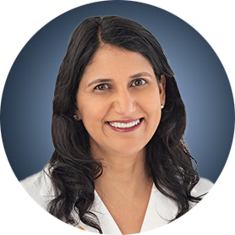
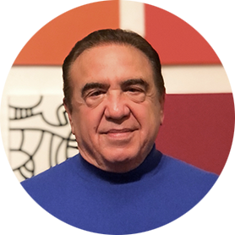

Faculty
Rashmi Chugh, MD
Professor of Internal Medicine
Division of Hematology/Oncology
Rogel Comprehensive Cancer Center
University of Michigan
Ann Arbor, Michigan
MODERATOR
Neil Love, MD
Research To Practice
Miami, Florida
Mrinal Gounder, MD
Associate Attending
Sarcoma Medical Oncology, Early Drug Development (Phase I)
Physician Ambassador – India and Asia, Bobst International Center
Memorial Sloan Kettering Cancer Center
Associate Professor of Medicine
Weill Cornell School of Medicine, Cornell University
New York, New York

Slide 3
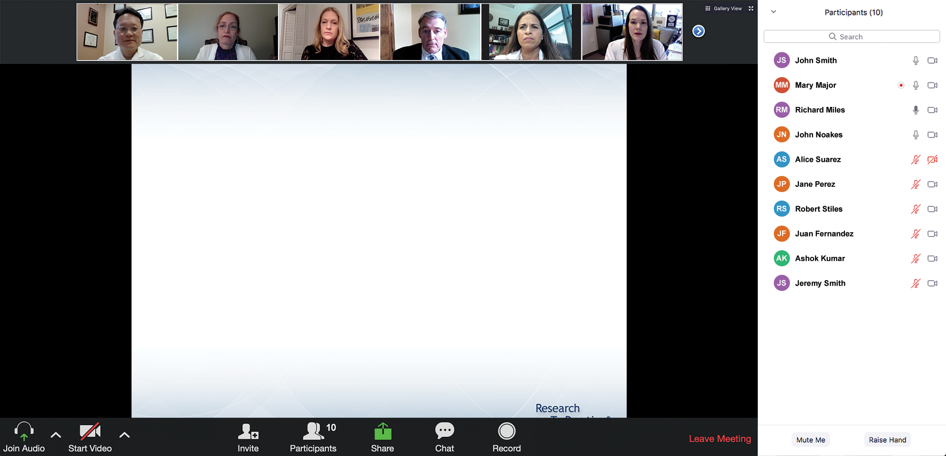
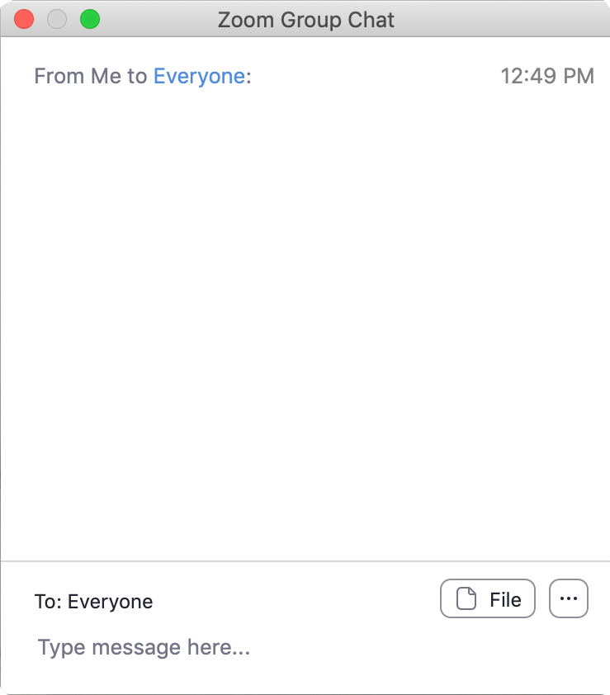
We Encourage Clinicians in Practice to Submit Questions
Feel free to submit questions now before the program begins and throughout the program.

Slide 4
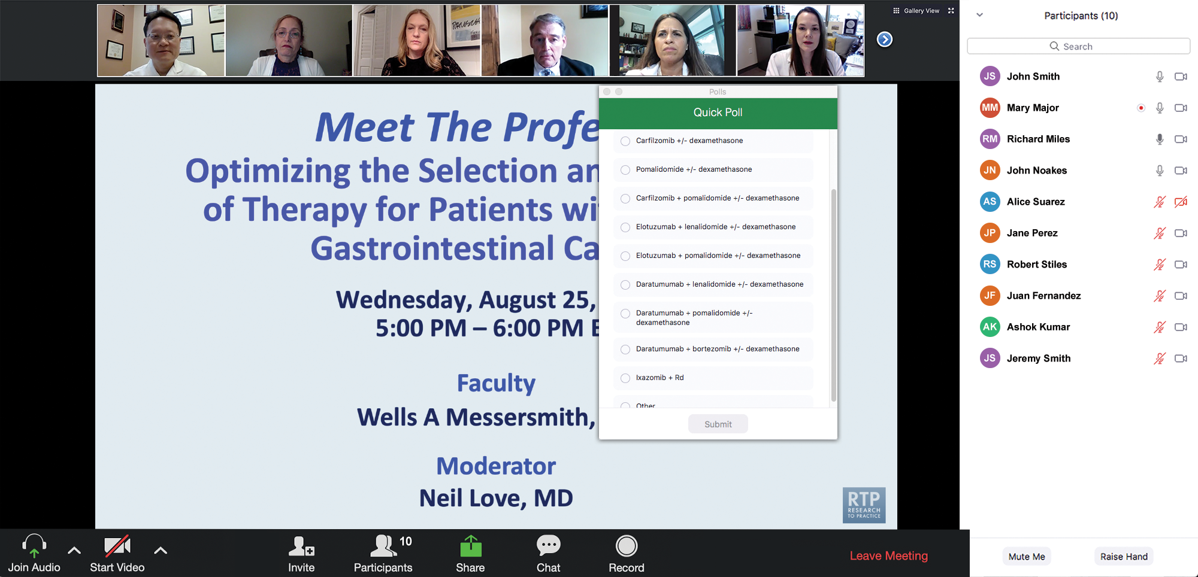
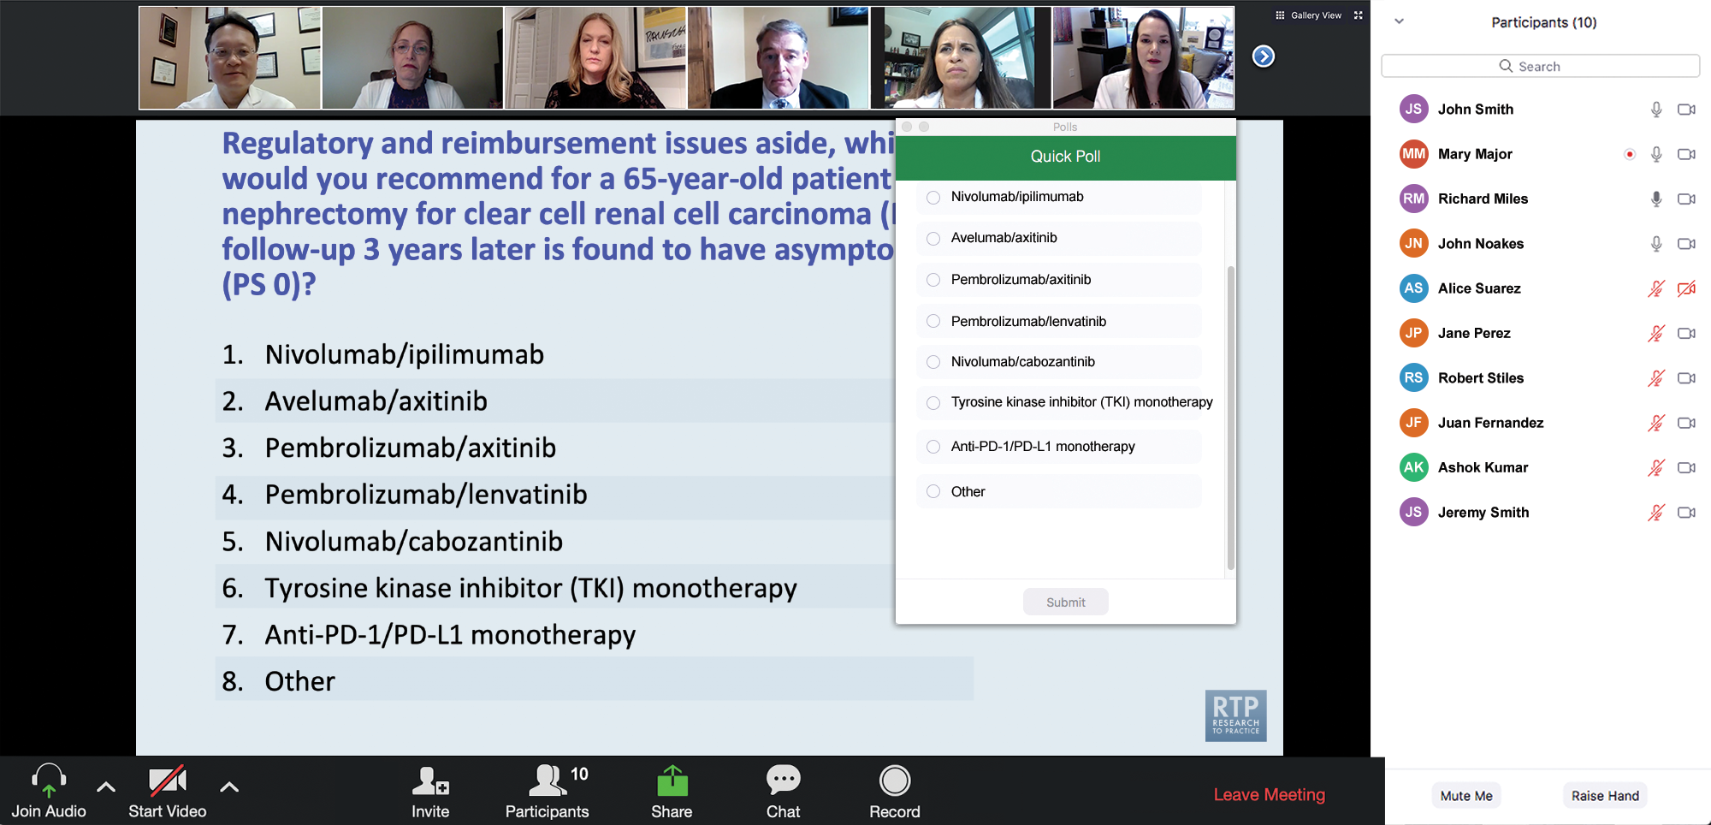
Clinicians in the Audience, Please Complete the Pre- and Postmeeting Surveys
Quick Survey
Quick Poll

Slide 5
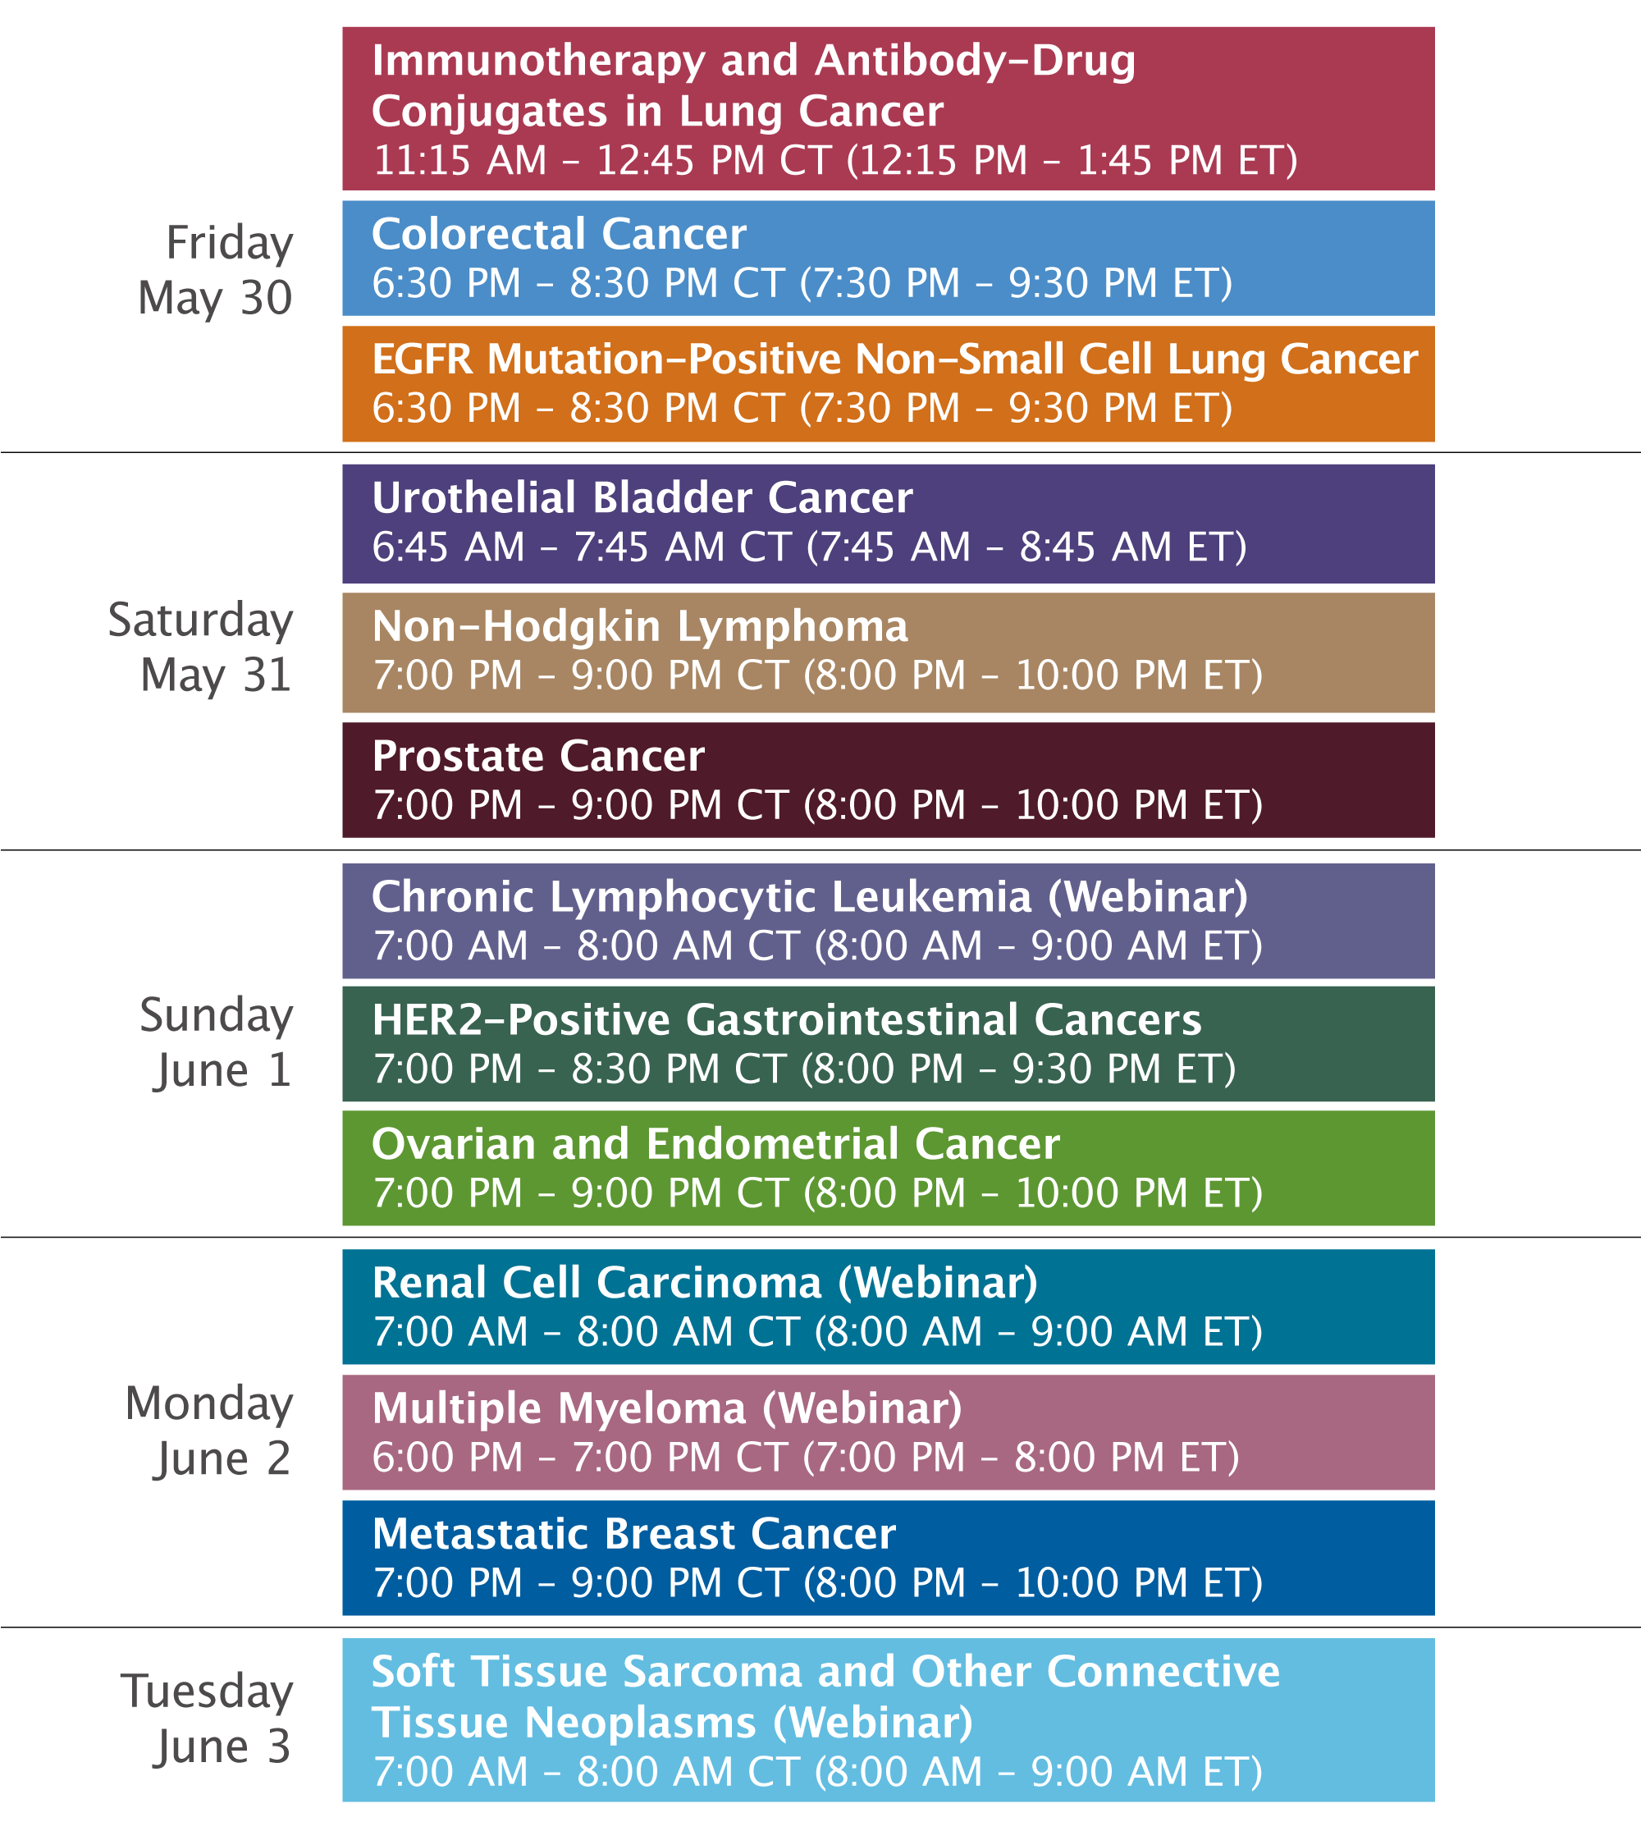

Slide 6
RTP Live from Chicago: Investigator Perspectives on
Available Research Findings and Challenging Questions in the Management of Soft Tissue Sarcoma and
Other Connective Tissue Neoplasms
Tuesday​, June 3, 2025
7:00 AM – 8:00 AM CT (8:00 AM – 9:00 AM ET)
Faculty
Rashmi Chugh, MD
Mrinal Gounder, MD
Moderator
Neil Love, MD

Slide 7
Dr Chugh — Disclosures
Faculty
Advisory Committees | Deciphera Pharmaceuticals Inc, Inhibrx, Recordati Rare Diseases
Contracted Research | Adaptimmune, Astex Pharmaceuticals, Ayala Pharmaceuticals, Cogent Biosciences, Inhibrx, Kronos Bio, Pfizer Inc, PharmaMar, Polaris Pharmaceuticals

Slide 8
Dr Gounder — Disclosures
Faculty
Consulting Agreements | Aadi Bioscience, Avacta Therapeutics, Ayala Pharmaceuticals, Epizyme Inc, Ikena Oncology, Kura Oncology, Orion Corporation, Parabilis Medicines, Rain Oncology, Regeneron Pharmaceuticals Inc, Syros Pharmaceuticals Inc
Contracted Research | Avacta Therapeutics, Ayala Pharmaceuticals, Ikena Oncology, Immunome, Ipsen Biopharmaceuticals Inc, Kura Oncology, Orion Corporation, Parabilis Medicines, Pyxis Oncology, Tango Therapeutics, Vivace Therapeutics
Data and Safety Monitoring Boards/Committees | Kura Oncology

Slide 9
Dr Love — Disclosures
Dr Love is president and CEO of Research To Practice. Research To Practice receives funds in the form of educational grants to develop CME activities from the following companies: Aadi Bioscience, AbbVie Inc, ADC Therapeutics, Alexion Pharmaceuticals, Amgen Inc, Array BioPharma Inc, a subsidiary of Pfizer Inc, Arvinas, Astellas, AstraZeneca Pharmaceuticals LP, Aveo Pharmaceuticals, Bayer HealthCare Pharmaceuticals, BeiGene Ltd, Black Diamond Therapeutics Inc, Blueprint Medicines, Boehringer Ingelheim Pharmaceuticals Inc, Bristol Myers Squibb, Clovis Oncology, Coherus BioSciences, CTI BioPharma, a Sobi Company, Daiichi Sankyo Inc, Eisai Inc, Elevation Oncology Inc, Exact Sciences Corporation, Exelixis Inc, Genentech, a member of the Roche Group, Genmab US Inc, Geron Corporation, Gilead Sciences Inc, GSK, Hologic Inc, ImmunoGen Inc, Incyte Corporation, Ipsen Biopharmaceuticals Inc, Jazz Pharmaceuticals Inc, Johnson & Johnson, Karyopharm Therapeutics, Kite, A Gilead Company, Kura Oncology, Legend Biotech, Lilly, MEI Pharma Inc, Merck, Mersana Therapeutics Inc, Mirati Therapeutics Inc, Mural Oncology Inc, Natera Inc, Novartis, Novartis Pharmaceuticals Corporation on behalf of Advanced Accelerator Applications, Novocure Inc, Nuvalent, Pfizer Inc, Pharmacyclics LLC, an AbbVie Company, Puma Biotechnology Inc, Regeneron Pharmaceuticals Inc, Rigel Pharmaceuticals Inc, R-Pharm US, Sanofi, Seagen Inc, Servier Pharmaceuticals LLC, SpringWorks Therapeutics Inc, Stemline Therapeutics Inc, Syndax Pharmaceuticals, Taiho Oncology Inc, Takeda Pharmaceuticals USA Inc, TerSera Therapeutics LLC, and Tesaro,
A GSK Company.

Slide 10
Commercial Support
This activity is supported by educational grants from Aadi Bioscience and SpringWorks Therapeutics Inc.
Research To Practice CME Planning Committee Members,
Staff and Reviewers
Planners, scientific staff and independent reviewers for Research To Practice have no relevant conflicts of interest to disclose.

Slide 11
This educational activity contains discussion of
non-FDA-approved uses of agents and regimens. Please refer to official prescribing information for each product for approved indications.

Slide 12
Agenda
Introduction: Current Role of General Medical Oncologists in the Treatment of Soft Tissue Sarcomas (STS)
Module 1: Incorporation of Novel Agents and Strategies into the Management of STS — Faculty Presentation
Module 2: Incorporation of Novel Agents and Strategies into the Management of STS — Survey Questions
Module 3: Evolving Treatment Paradigm for Locally Aggressive STS
— Faculty Presentation
Module 4: Evolving Treatment Paradigm for Locally Aggressive STS
— Survey Questions
Module 5: ASCO 2025

Slide 13
Agenda
Introduction: Current Role of General Medical Oncologists in the Treatment of Soft Tissue Sarcomas (STS)
Module 1: Incorporation of Novel Agents and Strategies into the Management of STS — Faculty Presentation
Module 2: Incorporation of Novel Agents and Strategies into the Management of STS — Survey Questions
Module 3: Evolving Treatment Paradigm for Locally Aggressive STS
— Faculty Presentation
Module 4: Evolving Treatment Paradigm for Locally Aggressive STS
— Survey Questions
Module 5: ASCO 2025

Slide 14
Survey of 50 Community-Based
General Medical Oncologists
May 14-24, 2025

Slide 15
Number of Oncologists Treating Patients with…
 |  | Median (Range)
Soft tissue sarcomas | 46 (94%) | 3 (0-60)
Desmoid tumors | 22 (44%) | 0 (0-10)
Tenosynovial giant cell tumor (TGCT) | 8 (16%) | 0 (0-2)

Slide 16
Questions from General Medical Oncologists —
Role of GMOs in STS Treatment
Our large tertiary institution that sees sarcoma does not take many insurances and can be challenging to get them into multidisciplinary providers. In rural community virtual evals may be of benefit particularly if surgical therapy is not front-line therapy.
I think the biggest impediment is lack of large numbers of patients with these diseases, need for collaboration with experts but they can be difficult to access.

Slide 17
Agenda
Introduction: Current Role of General Medical Oncologists in the Treatment of Soft Tissue Sarcomas (STS)
Module 1: Incorporation of Novel Agents and Strategies into the Management of STS — Faculty Presentation
Module 2: Incorporation of Novel Agents and Strategies into the Management of STS — Survey Questions
Module 3: Evolving Treatment Paradigm for Locally Aggressive STS
— Faculty Presentation
Module 4: Evolving Treatment Paradigm for Locally Aggressive STS
— Survey Questions
Module 5: ASCO 2025

Slide 18
Incorporation of Novel Agents and Strategies into the Management of Soft Tissue Sarcomas
Research to Practice
ASCO Soft Tissue Sarcoma Live Webinar
Rashmi Chugh, MD
Professor of Internal Medicine
Sarcoma Clinical Research Program Co-Lead
University of Michigan Rogel Cancer Center
June 3, 2025

Slide 19
Outline
Introduction and historical approach to advanced soft tissue sarcoma (STS)
Sequencing treatments and management paradigms for STS
Novel targeted therapies in specific histologies
  PEComa
  Epithelioid Sarcoma
  Synovial Sarcoma
  Alveolar Soft Part Sarcoma
Future Directions

Slide 20
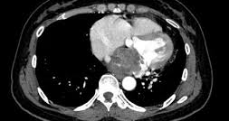
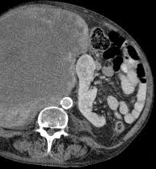
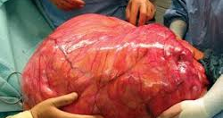
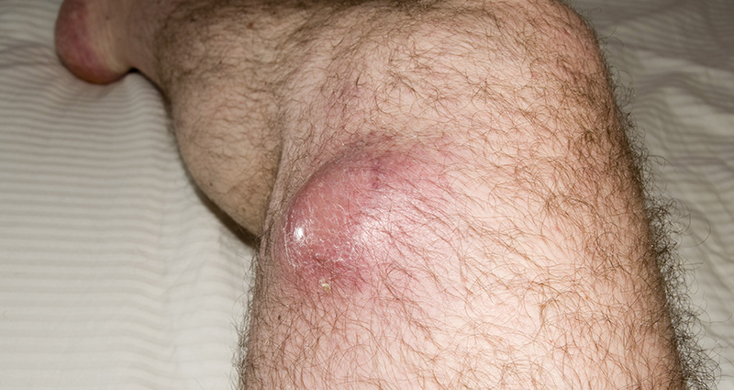
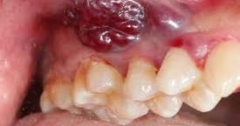
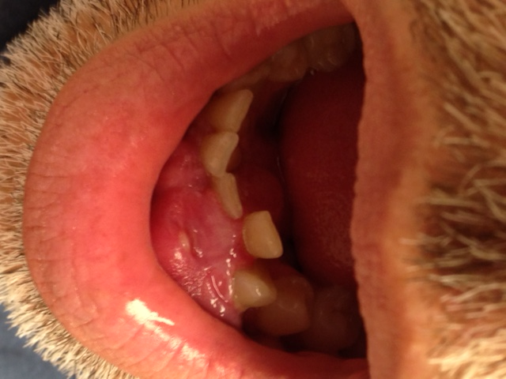
Sarcoma are cancers of the connective tissue which can appear any place, any time, any age, in any form
Malignancy of mesenchymal tissue
Over 100 histologic subtypes
Bone Sarcoma
~3500 cases/yr (20%)
Major subgroups:
Osteosarcoma
Ewing sarcoma
Chondrosarcoma
Soft Tissue Sarcoma (STS)
~13000 cases/yr (80%)
Major subgroups:
  Gastrointestinal Stromal Tumor (GIST)
  Pediatric rhabdomyosarcoma
  Aggressive “chemo-sensitive” histologies
  Indolent “chemo-resistant” histologies
Notes:
As you all know, Sarcomas are very heterogeneous, meaning they can look very differently. There are about 100 different types or histologies of sarcoma that can occur in any location in the body, ranging from the heart here, the leg, the mouth, the back of the abdomen, the gums or really any place you could imagine. They can also occurring in any age. One of the most critical pieces in taking care of patients with sarcoma, is knowing what type it is so we can best treat it. That is usually accomplished by doing a biopsy and looking at the tumor under the microscope.

Slide 21
Angiosarcoma
Angiosarcoma
Myxofibrosarcoma
Liposarcoma
HGUPS
Myxofibrosarcoma
Lump
Malignant solitary fibrous tumor
LMS
Osteosarcoma
HGUPS
MPNST
Pleomorophic Rhabdomyosarcoma
Synovial Sarcoma
Liposarcoma
Leiomyosarcoma
S
P
L
I
T
Angiosarcoma
Myxofibrosarcoma
Malignant Solitary Fibrous Tumor
HGUPS
Epithelioid sarcoma
Liposarcoma
Leiomyosarcoma
Peripheral Nerve Sheath Tumor
Malignant SFT
Pleomorphic Rhabdomyosarcoma
Epithelioid sarcoma
PNST
Synovial Sarcoma
Pleomorphic Rhabdomyosarcoma
Synovial Sarcoma

Slide 22

Drug | Response rate (%)
Doxorubicin | 15% (10-25%)
Ifosfamide | 15% (7-41%)
Dacarbazine | 10% (4-18%)
Liposomal doxorubicin | 10% (9-50%)
Gemcitabine | 10% (5-40%)
Pazopanib | 4.5%
Common Combinations
Doxorubicin/ifosfamide
Doxorubicin/dacarbazine
Doxorubicin/trabectedin
Gemcitabine/docetaxel
Gemcitabine/dacarbazine

Slide 23
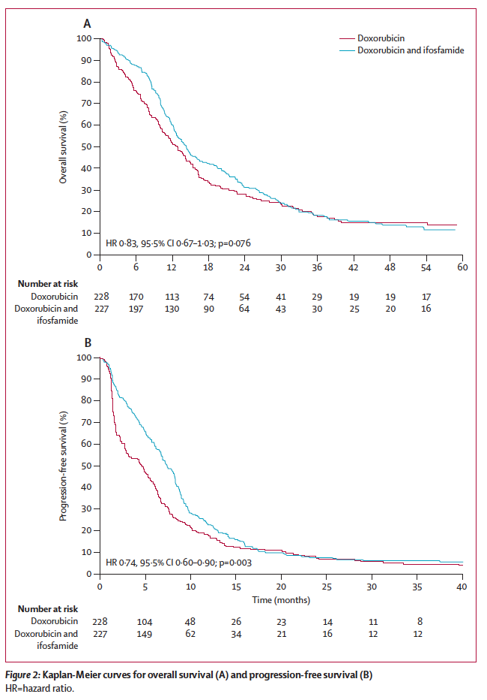
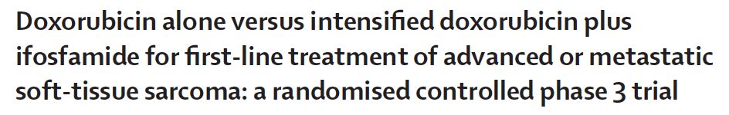
Therapy for Advanced STS: Single Agent Doxorubicin vs Combination
Progression-free
Survival
Dox (75 mg/m²/cycle vs Dox/Ifos (10 g/m²/cycle)
No significant difference in median OS: 12.8 vs 14.3 mo (p=0.076)
Significant difference in median PFS: 4.6 vs 7.4 mo (p=0.003)
Increased toxicity with combination
G3/4 Febrile Neutropenia: 13 vs 46%
  Thrombocytopenia: 1 vs 33%
Increased Response rate with combination: 14% vs 26%
Overall
Survival
→Reserve doxorubicin combination for fit patients who may benefit from response and can tolerate toxicities
Judson et al; Lancet Oncol. 2014 Apr;15(4):415-23.

Slide 24
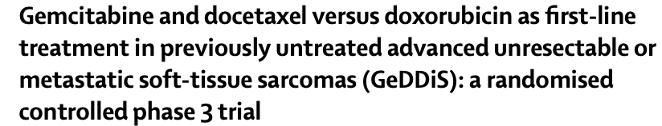
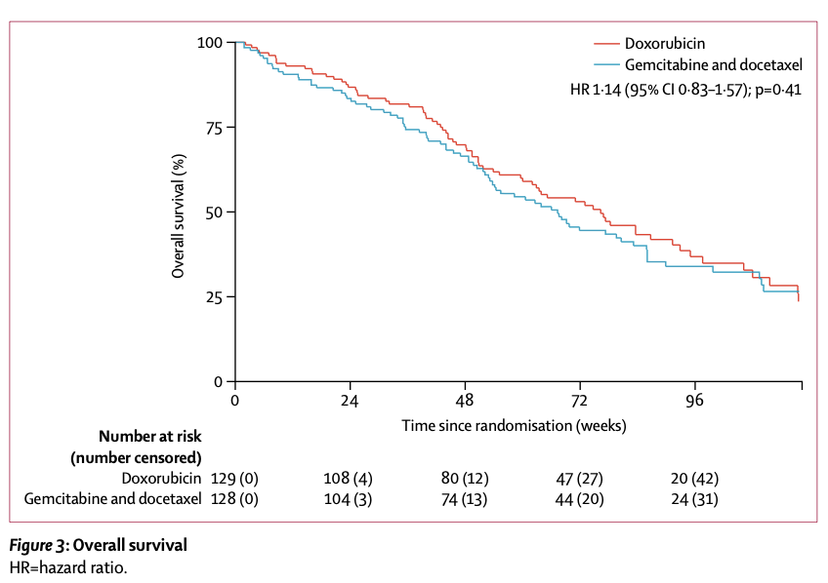
Therapy for Advanced STS: Doxorubicin vs Gemcitabine/Docetaxel
Overall
Survival
Dox (75 mg/m²/cycle vs Gem (675 mg/m2 D1/8)/Doce (75 mg/m² D8)
No significant difference in 24 week-PFS: 46.3% vs 46.4%
No Significant difference in median PFS: 23.3 vs 23.7 weeks (p=0.06)
Similar Response Rates: 19% vs 20%
Similar toxicity with Gem/Doce but overall lower appeal
  Global health score lower with Gem/doce
  More infusion trips, more treatment delays, early stopping with gem/doce
→Gemcitabine/docetaxel not superior in first line, Doxorubicin should remain as standard of care.
Seddon,et al.The Lancet Oncology, 2017:Volume 18, Issue 10, 1397 - 1410

Slide 25
Approach to Therapy for Advanced STS
Unlimited spectrum of disease
Limited patients, across the ages
Limited effective systemic agents
→ Heavily rely on local therapies even for metastatic disease (surgery, radiation, IR)
Most histologies start with doxorubicin
New strategies desperately needed

Slide 26
Molecular Drivers of Sarcoma
Approximately 1/3 of sarcoma with known molecular drivers/aberrations
Sarcoma Histology | Translocation
Ewing Sarcoma | EWSR1::FLI1, EWSR1::ERG, FUS::ERG
Synovial Sarcoma | SYT::SSX1, SYT::SSX2, SYT::SSX4
Desmoplastic small round cell tumor | ESWR1::WT1
Alveolar rhabdomyosarcoma | PAX3::FOX01, PAX7::FOX01
Alveolar soft part sarcoma | ASPL::TFE3
Low grade Fibromyxoid Sarcoma | FUS::CREB3L1
Sarcoma Histology | Molecular aberration
Gastrointestinal stromal tumor | KIT, PDGFR mutation
Well-differentiated/De-differentiated liposarcoma | 12q amplification (MDM2/CDK4)
Leiomyosarcoma | PTEN, Rb, ATRX
PEComa | TSC1/2 mutations
→Focus therapies based on molecular driver/histology

Slide 27
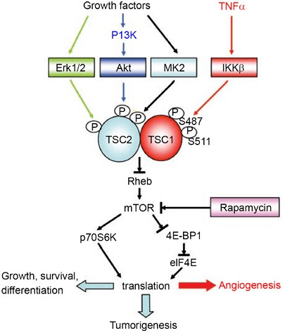
Perivascular Epithelioid Cell tumor (PEComa)
“Ultra-rare” soft tissue sarcoma, often originating in uterus or viscera. Muscle/melanocytic markers
<~40-80 cases/ year in US
Molecular aberrations common in TSC1 or TSC2 are common, which negative regulate mTOR signaling pathway. ^{1.2}
  Tuberous sclerosis patients predisposed to PEComa
  Along a spectrum of diseases with lymphangiomyomatosis, angiomyolipoma
”Malignant” PEComa is aggressive and often metastasizes
  Cytotoxic chemotherapy with limited benefit
  mTOR inhibitors have shown variable benefit in case reports^{3,4}
Courtesy of Christopher Fletcher
FWu, Y., Zhou, B. Kinases meet at TSC. Cell Res 17, 971–973 (2007).
¹Martignoni et al., Virchows Arch 2008; ²Gao et al., Signal Transduction 2015 ; ³Wagner et al., JCO 2010; ⁴Dickson et al., Int J Cancer 2013;

Slide 28
nab-Sirolimus
Albumin-bound sirolimus nanoparticles (ABI-009) - novel IV mTOR inhibitor with significantly higher intratumoral drug accumulation and mTOR target (p70S6k) suppression at equal dose vs oral mTOR inhibitors
Oral mTOR inhibitors with variable absorption, require therapeutic level monitoring, and have incomplete target suppression
Phase 2 AMPECT study
Histologically confirmed advanced PEComa, No prior mTOR Inhibitors
Treatment:
nab-Sirolimus 100 mg/m² IV d 1,8 q 21 d until progression or unacceptable safety

Slide 29
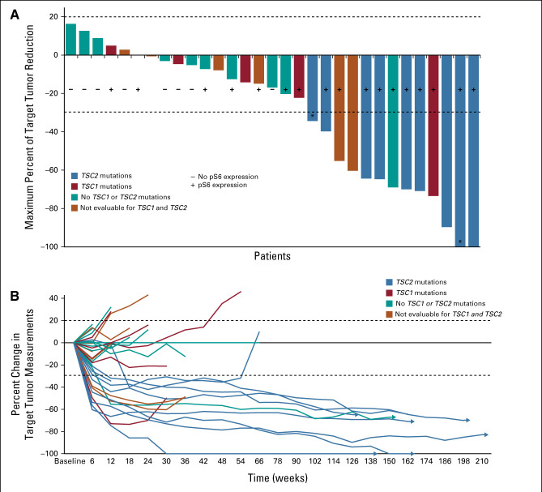
AMPECT: Phase 2 study of nab-Sirolimus in PEComa
31 evaluable patients
Efficacy: ORR 39%, SD 52%
Median PFS 10.6 months
Median OS 40.8 months
Toxicity:
All grade: Stomatitis (82%), fatigue (62%), Rash (62%)
→nab-sirolimus FDA-approved in 2021 for locally advanced unresectable or metastatic malignant PEComa
Wagner AJ et al. J Clin Oncol. 2024 May 1;42(13):1472-1476

Slide 30
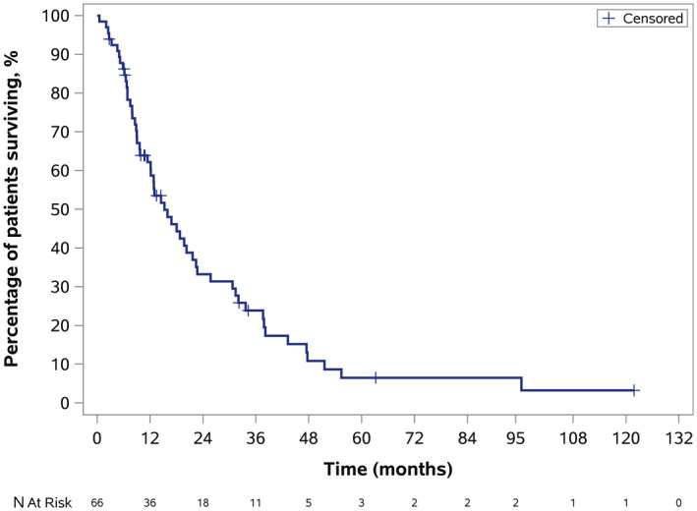
Epithelioid Sarcoma
Ultra-rare sarcoma, <1% of all STS
Variable natural history: indolent to aggressive
  5 year OS localized disease: 75%
  1 year OS metastatic disease: 42%
Real world data collection from 5 US centers:
  74 patients- majority male, median age 33
  rwORR - 1st line: 14.9%
  2nd line: 9.4%
  rwDCR - 1st line: 20.3%
    2nd line: 19.8%
Overall
Survival
Characterized by loss of INI1/SMARCB1 of the Chromatin remodeling complex causing SWI/SNF dysfunction
→Leads to aberrant EZH2 activity and oncogenic dependence
Gounder MM, et al. Cancer. 2021 Apr 15;127.

Slide 31
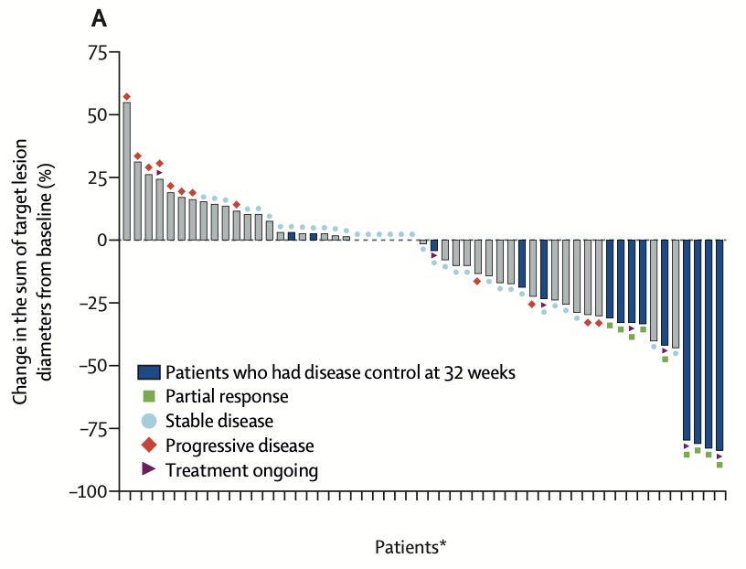
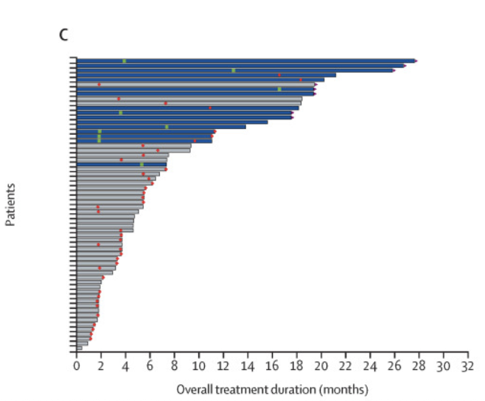
Tazemetostat (EZH2 inhibitor) in advanced epithelioid sarcoma with loss of INI1/SMARCB1
RR: 15%
Phase 2 basket study-
Cohort 5 epithelioid sarcoma with confirmed INI-1 loss
Tazemetostat 800 mg twice daily
Efficacy: 62 patients
ORR: 15%, median DOR not reached (9.2mo-NE)
Median PFS 5.5 months
Median OS 19.0 months
Toxicity:
Well tolerated. Grade 3 or worse Aes:
anaemia (four [6%]) and weight loss (two [3%]).
Median overall treatment duration: 5.5 mos
→Tazemetostat received accelerated FDA approval in 2020 for advanced epithelioid sarcoma
Gounder M, et al. Lancet Oncol. 2020 Nov;21(11)

Slide 32
Adoptive T cell therapy in synovial sarcoma
Synovial sarcoma is a rare aggressive soft tissue sarcoma
  ~1000 cases annually in US
  Slight male predominance, younger adult population
Characterized by SSX-SYT translocation
Majority of tumors express NY-ESO-1 and MAGE-A4 antigens
Afamitresgene autoleucel (Afami-cel)
High-affinity TCR therapy to MAGE-A4 antigen
TCR gene transduced into autologous T cells via lentiviral vector
Restricted to patients with specific HLA-A*02 genotypes

Slide 33
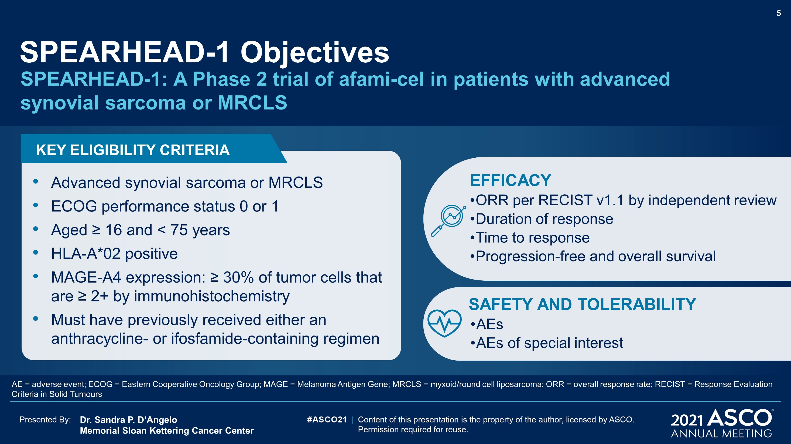

Slide 34
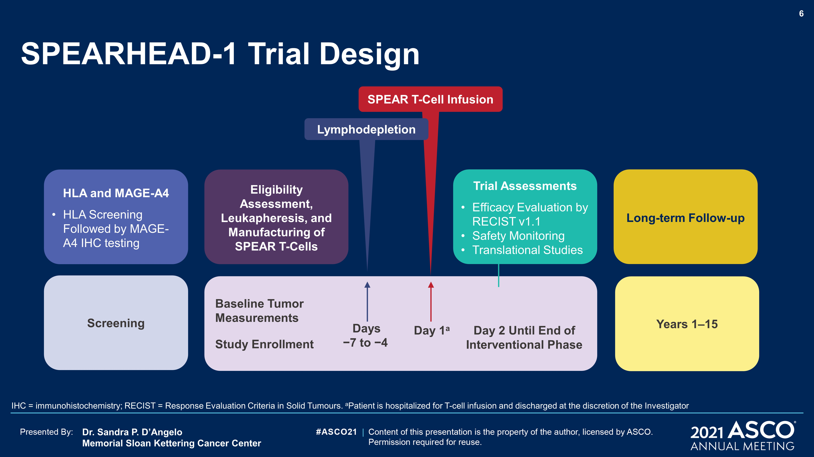
SPEARHEAD-1 Trial Design
Content of this presentation is the property of the author, licensed by ASCO. Permission required for reuse.

Slide 35
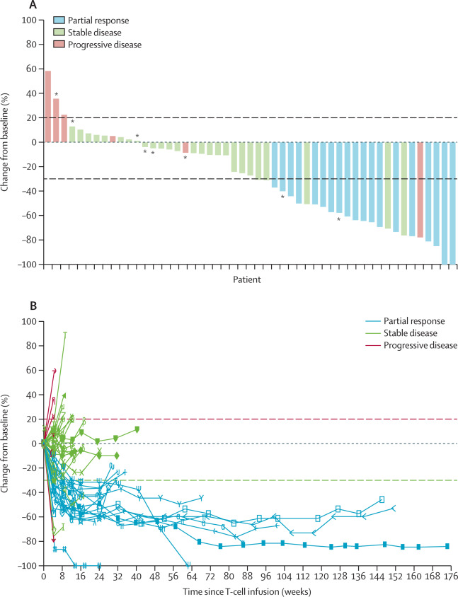
SPEARHEAD-1: Afami-cel
Overall Response Rate: 37%.
Synsarc: 39%
MRCLS: 25%,
Duration of Response:
Synsarc: 11.6 mo
MRCLS: 4.2 mo
Results:
44 patients with synovial sarcoma
8 patients with Myxoid Round Cell Liposarcoma (MRCLS)
AEs:
Cytokine release syndrome: 71% (1 grade 3 event)
Grade ≥3 Cytopenias :
  Lymphopenia 50 [96%]neutropenia 44 [85%],
  leukopenia 42 [81%]
D'Angelo SP et al. .Lancet. 2024 Apr 13;403(10435):1460-1471.

Slide 36
Synovial Sarcoma Case History
50 y/o presented with dyspnea
→6.7 cm left hilar mass- resected: high grade synovial sarcoma with positive margins. Rx with adjuvant radiation. Recurred L paraspinal.
→Doxorubicin/ifosfamide x 2 cycles with poor tolerance and then single agent doxorubicin →progressive disease
→Pazopanib x 5 months →progressive disease.
→Screened for SPEARHEAD Study- Eligible based on HLA type and MAGEA4 expression. Bridge therapy with trabectedin x 3
→Pheresis
→Fludarabine/Cyclophosphamide conditioning followed by ADP-A2M4 SPEAR T-cells

Slide 37
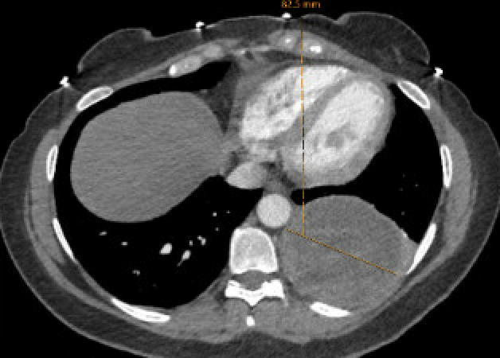
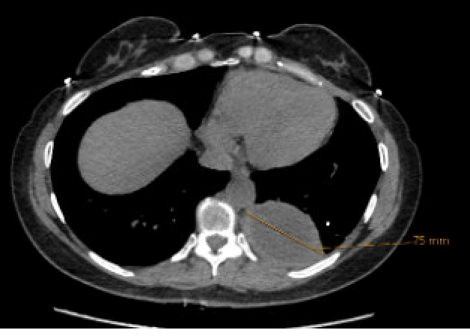
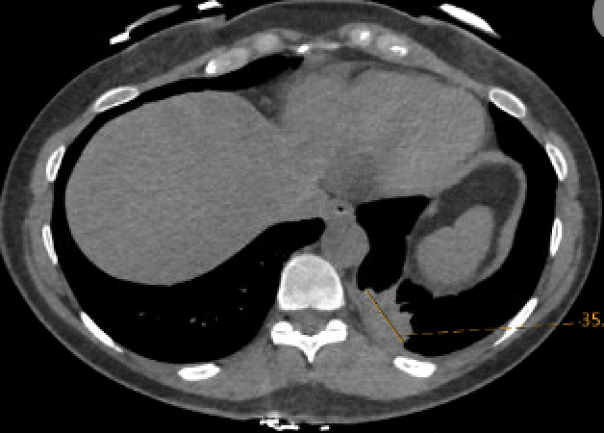
8/2/24: FDA Approves Afamitrasgene Autoleucel for Metastatic Synovial Sarcoma via Accelerated Approval
Screening scan
4 month scan
12 month scan
Ongoing Partial Response at 12 months!
Only applicable for a minority of pts
Screened (n=330)→HLA-A*02 present (n=176)→MAGE-A4 positive (n=106)→Received T cell therapy (n=37)

Slide 38
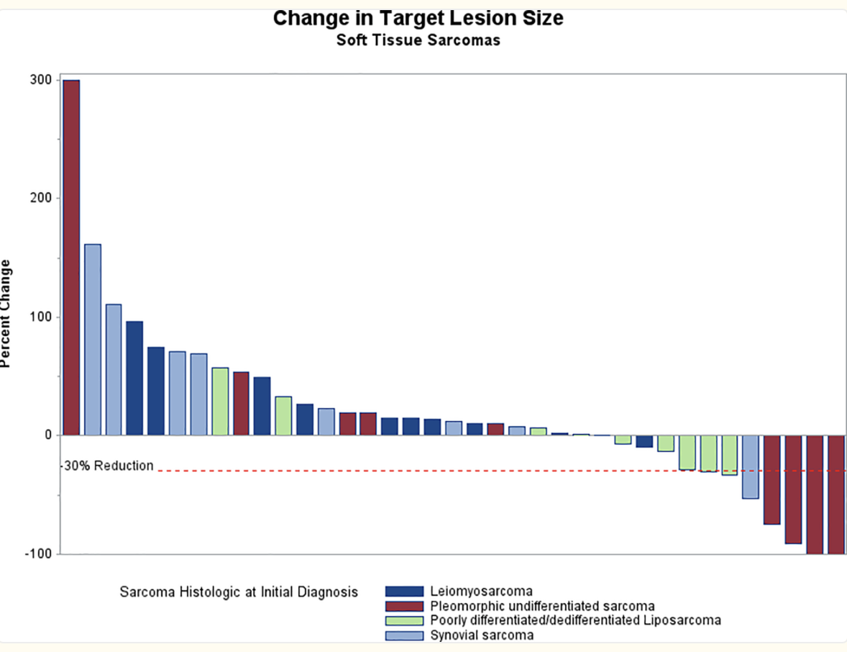
Checkpoint inhibitors in STS
Checkpoint inhibitors with greatest signal of activity in few histologies
-Undifferentiated Pleomorphic Sarcoma:
-RR ~14-23%
-Dedifferentiated Liposarcoma:
-RR~10%
-Angiosarcoma:
-Nivo/ipi: RR 25% (4/16). 3 CRs in cutaneous. 6-month PFS:38%.³
SARC028: Pembrolizumab in STS¹
Subtype | Responders | RR | Expansion
Leiomyosarcoma | 0 | 0%
HGUPS | 1 CR, 3 PR | 40% | 23%
Liposarcoma | 2 PR | 20% | 10%
Synovial | 1PR | 10%
-PDL1/TMB status not predictive, Class E immune phenotype predictive on correlative studies²
-Positive signals seen in neoadjuvant setting with radiation and UPS/dedifferentiated liposarcoma
¹Tawbi et al. Lancet Oncol. 2017. ²Wagner MJ et al. , J Immunother Cancer. 2021. ³Petitprez F et al. Nature. 2020 Jan

Slide 39
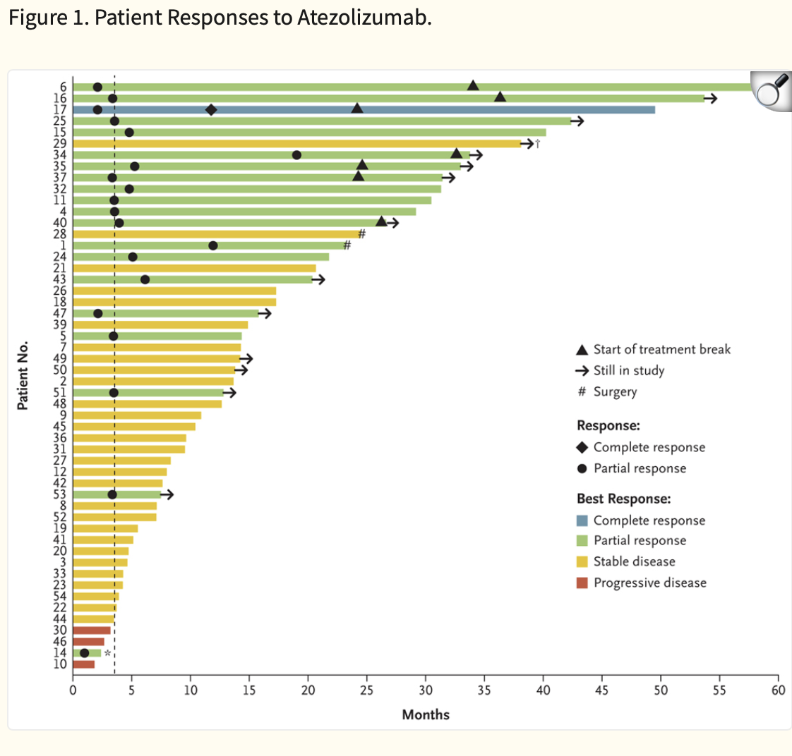
Atezolizumab in Alveolar Soft Part Sarcoma (ASPS)
ASPS is an ultra-rare STS
-most common in AYA, population
-indolent course (5-year OS: 20-46%)
-often metastatic at diagnosis
-ASPL::TFE3
-resistant to cytotoxics
Atezolizumab (PDL1 mAb) Phase 2 study in advanced ASPS
-ORR of 37% (95% CI, 24–51)
-mPFS: 20.8 mos, mDOR: 24.7 mos,
→atezolizumab approved in 2021 for patients >2 years old with unresectable or metastatic ASPS
Chen AP, et al. N Engl J Med. 2023 Sep 7;389(10):911-921.

Slide 40
Histology-specific agents in (non-GIST) STS
Histology | FDA approved
Alveolar soft part sarcoma | Atezolizumab
Epithelioid sarcoma | Tazemetostat
Liposarcoma | Trabectedin Eribulin
Leiomyosarcoma | Trabectedin
Synovial sarcoma | Afamitresgene autoleucel
Giant Cell tumor of bone | Denosumab
Desmoid tumor | Nirogacestat
Tenosynovial giant cell tumor | Pexidartinib Vimseltinib
Histology | NCCN Compendia Listed
Angiosarcoma | Paclitaxel, Checkpoint inhibitors
Alveolar soft part sarcoma | Sunitinib, pazopanib, pembrolizumab + axitinib
Undifferentiated pleomorphic sarcoma | Checkpoint inhibitors

Slide 41
Future Directions….Combinations….and more Targeting
Standard +Targeted
Doxorubicin + Trabectedin (Improved PFS/ORR/OS in LMS, NEJM 2024)
Doxorubicin +Lurbinectedin in Leiomyosarcoma (NCT06088290)
Immunotherapy ++
Doxorubicin + pembrolizumab in UPS (NCT06422806)
Nivolumab + sunitinib (IMMUNOSARC, Asco 2025)
Tazemetostat + nivolumab + ipilimumab in SMARCA4-deficient (NCT05407441)
Pembrolizumab +Cabozantinib (PEMBROCABOSARC\NCT05182164)
Antibody-drug Conjugates
B7H3, KIT

Slide 42
Therapies in STS Summary
Historically treat most aggressive histologies with doxorubicin initially.
  Combinations used when applicable
  Prioritization of quality, toxicity measures in addition to responses
  Local therapies key adjuncts
  Many nuances to consider! Refer to sarcoma center when possible
Recently approved agents are histology and/or pathway specific and are preferred in earlier lines when applicable (.i.e- mTOR, EZH2, afami-cel)
Future…
  Combination strategies
  Many additional pathways of interest based on driver
Thank you! rashmim@med.umich.edu

Slide 43
Agenda
Introduction: Current Role of General Medical Oncologists in the Treatment of Soft Tissue Sarcomas (STS)
Module 1: Incorporation of Novel Agents and Strategies into the Management of STS — Faculty Presentation
Module 2: Incorporation of Novel Agents and Strategies into the Management of STS — Survey Questions
Module 3: Evolving Treatment Paradigm for Locally Aggressive STS
— Faculty Presentation
Module 4: Evolving Treatment Paradigm for Locally Aggressive STS
— Survey Questions
Module 5: ASCO 2025

Slide 44
Questions from General Medical Oncologists —
Overview of STS
Would need a review from the beginning, I do not see these patients other than a few GIST patients, so I refer them elsewhere in my institution to a sarcoma expert.
Can you provide a practical overview of the key molecular alterations and typical clinical presentations associated with common STS subtypes, and how these factors influence prognosis and treatment selection?
Soft tissue sarcomas are so complicated and so rare, that I feel very uncomfortable managing these patients without the assistance of a sarcoma subspecialist.

Slide 45
Questions from General Medical Oncologists —
Overview of STS: Diagnosis
What are key mistakes in the community that providers do not consider when seeing patients in this setting prior to eval at tertiary centers?
When sarcoma is suspected by imaging, do you recommend core needle biopsy or referral to specialty surgeon first?

Slide 46
Questions from General Medical Oncologists —
Overview of STS: Molecular Testing
What molecular testing should be done for a patient with sarcoma?
How to select therapy based on histology
I would like to know more about molecular alterations and its implications on prognosis and treatment

Slide 47
Questions from General Medical Oncologists —
Perivascular Epithelioid Cell tumor (PEComa)
How strong is the clinical evidence supporting mTOR inhibitors in PEComa, and what are the key clinical features that would prompt you to consider this therapy?
Use of nab-sirolimus? No experience
Have you used nab-sirolimus as neoadjuvant therapy in borderline resectable perivascular epithelioid cell tumors (PEComas)?

Slide 48
Questions from General Medical Oncologists —
PEComa
51-year-old man was found to have 4 cm right breast mass. Pathology showed PEComa. Any role for adjuvant therapy?
What therapy do you give after progression on nab-sirolimus?

Slide 49
Agenda
Introduction: Current Role of General Medical Oncologists in the Treatment of Soft Tissue Sarcomas (STS)
Module 1: Incorporation of Novel Agents and Strategies into the Management of STS — Faculty Presentation
Module 2: Incorporation of Novel Agents and Strategies into the Management of STS — Survey Questions
Module 3: Evolving Treatment Paradigm for Locally Aggressive STS
— Faculty Presentation
Module 4: Evolving Treatment Paradigm for Locally Aggressive STS
— Survey Questions
Module 5: ASCO 2025

Slide 50
Mrinal Gounder, MD
Sarcoma Medical Oncology | Phase 1 Drug Development Program
Physician Ambassador – India and Asia
Memorial Sloan Kettering Cancer Center email – gounderm@mskcc.org
Desmoid Tumor and TGCT

Slide 51
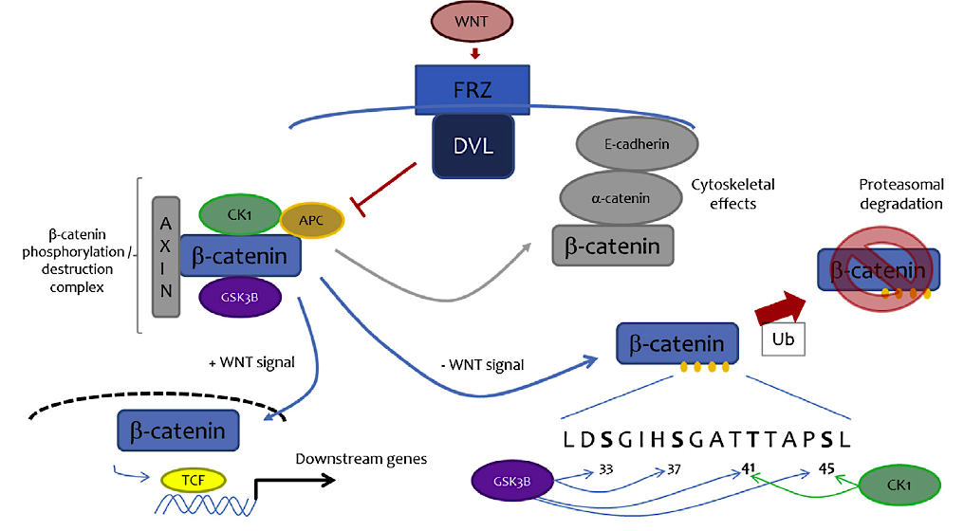
Either APC loss or CTNNB1 (beta-catenin) mutation found in DT
Both are mediators of the wingless signaling pathway, which gives rise to an uncontrolled proliferation of fibroblasts
Desmoid Tumor Working Group. Eur J Cancer. 2020 Mar:127:96-107.

Slide 52
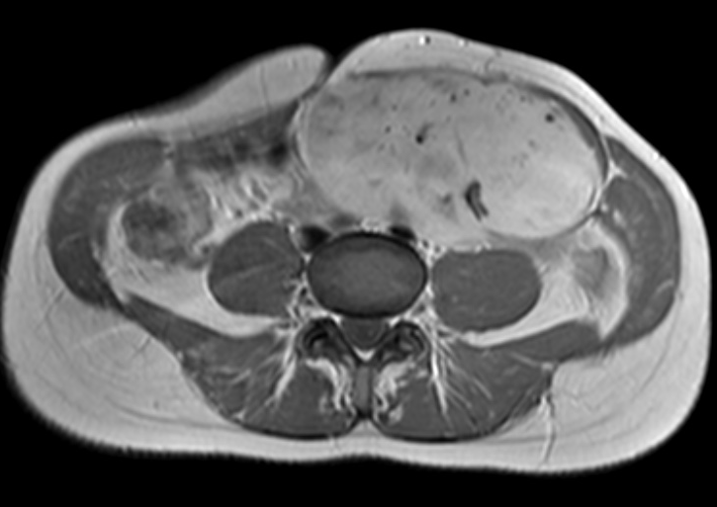
Criteria for Active Treatment
Cosmesis
Pregnancy
Progression
Pain
Surgery remains in the initial lines of treatments

Slide 53
Tyrosine Kinase Inhibitors
Reference | n | Inclusion Criteria | Treatment Dose, mg | Treatment Duration | ORR, % | 6-Month PFS, % | 12-Month PFS, % | 24-Month PFS, %
Heinrich et al, 2006 | 19 | “Heavily pretreated patients” | Imatinib 800 mg | 325 days | 16 | 53 | 37 | NE
Penel et al, 2010 | 35 | “Radiological evidence for PD” | Imatinib 400 mg | 1 year | 11 | 80 | 67 | 55
Chugh et al, 2010 | 49 | “Locally advanced disease” | Imatinib 200-600 mg | Until PD 9 patients >3 years | 6 | 84 | 66 | NE
Kasper et al, 2017 | 38 | RECIST PD | Imatinib 800 mg | 2 years | 19 | 65 | 59 | 45
Sorafenib Gounder, 2018 | 50 | “Progressive or symptomatic” | Sorafenib 400 mg | Until PD | 33 | NE | 89 | 81
Pazopanib Toulmond, ASCO 2018 | 48 | RECIST PD | Pazopanib 800 mg | 1 year | 37 | 81 | 86 | NE
Nirogacestat Kummar, 2017 | 17 | “Progressive/ symptomatic” | Nirogacestat 300 mg | Until PD | 29 | 100 | 100 | 100
Notes:
Several groups have evaluated imatinib, sorafenib and pazopanib. The response rate and PFS for sorafenib and pazopanib seems to be highest to date. It is important to note that many of these drugs are not approved for use in desmoid tumors and thus use of these drugs is off-label use.

Slide 54
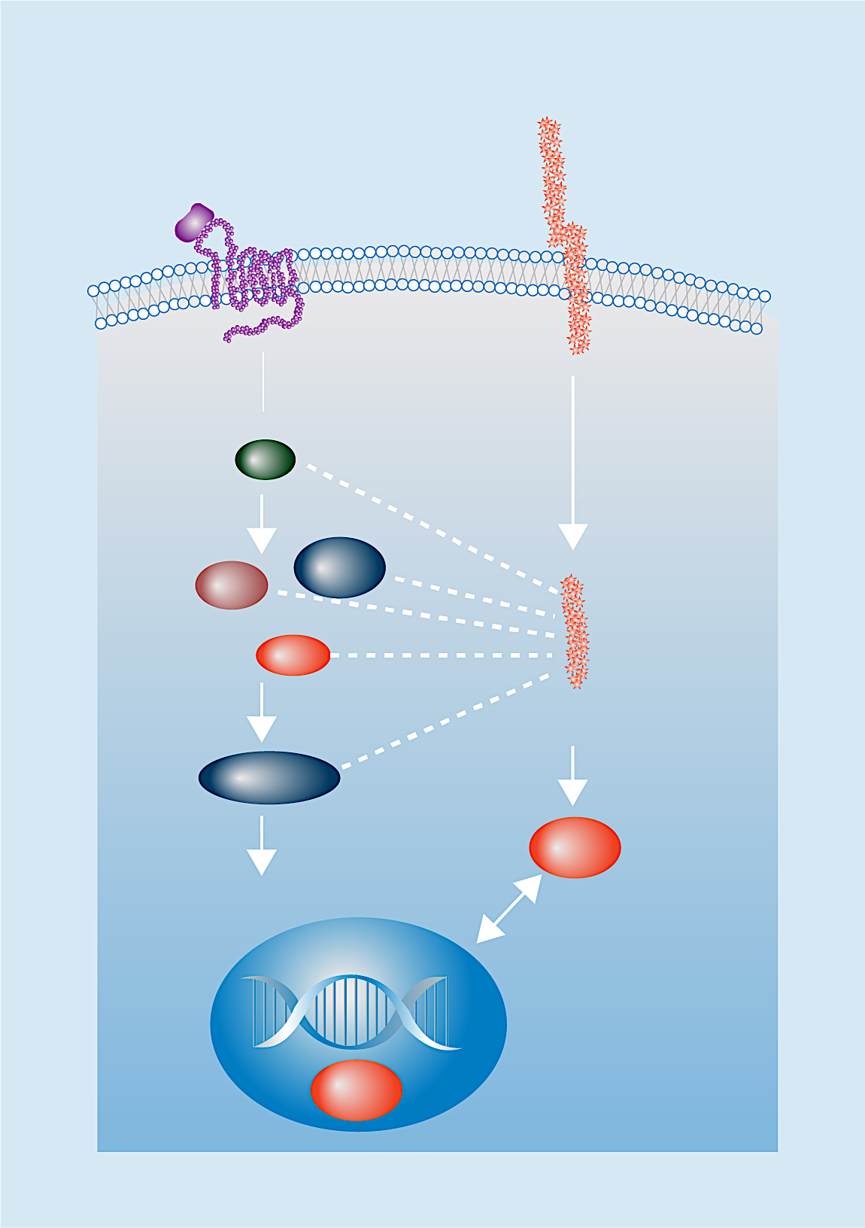
Gamma Secretase Inhibition in Desmoid Tumors
There is mechanistic rationale for the use of GSIs in DTs because these tumors highly express Notch, which can be blocked by GSIs^{5,6}
Wnt
pathway
Notch
pathway
Notch
Wnt
Extracellular
Plasma
membrane
Nirogacestat is an investigational, oral, selective, small-molecule
GSI that has shown evidence of antitumor activity in DTs
in phase 1 and 2 trials with a manageable AE profile^{1,7,8}
Intracellular
DvI
Axin
GSK3β
AL102 is an investigational, oral, potent inhibitor of gamma secretase
APC
NICD
β-catenin
Canonical Wnt signaling
HES1
Crosstalk
Tcf4
Image adapted from Andersson et al. Development (2011) and Bui and Kummar. Oncotarget (2017).
Notes:
DT, desmoid tumor; GSI, gamma secretase inhibitor; NICD, Notch intracellular domain.

Slide 55
DeFi: Phase 3 Study of Nirogacestat vs Placebo
Global, randomized, double-blind, placebo-controlled, phase 3 trial comparing the efficacy, safety, and tolerability
of nirogacestat vs placebo in adult patients with progressing DTs
142 patients randomized across 37 sites in North America and Europe
Adult eligible patients
Histologically confirmed DT with progressive disease per RECIST v1.1ª
    Treatment-naive with DT not amenable to surgery, or
    Refractory or recurrent disease (after ≥1 line of therapy)
Stratified by
tumor location
(intra- vs extra-abdominal)
28-day cycles
Nirogacestat
150 mg BID
Open-label nirogacestat
150 mg BID
Radiographic progressive disease^{b}
R
1:1
Placebo BID
Primary endpoint: PFS^{c}
Secondary endpoints: ORR and PROs, including symptom burden, physical/role function, and overall QoL^{d}
Primary Analysis Data Cutoff: April 7, 2022
Notes:
Kasper B et al. ESMO 2022. Abstract LBA2.
BID, twice-daily dosing; BPI-SF, Brief Pain Inventory–Short Form; DT, desmoid tumor; DTIS, GODDESS DT Impact Scale; DTSS, GODDESS DT Symptom Scale; EORTC QLQ-C30, European Organisation for Research and Treatment of Cancer Quality of Life Questionnaire-Core 30; GODDESS, GOunder/Desmoid Tumor Research Foundation DEsmoid Symptom/Impact Scale; RECIST, Response Evaluation Criteria in Solid Tumors.

Slide 56
Nirogacestat Significantly Reduced the Risk of Disease Progression
1.0
+
+
+
+
+
+
+
+
+
+
+
+
+
Nirogacestat
+
+
+
+
+
+
+
+
+
+
+
+
+
+
+
+
+
+
+
+
+
+
+
+
+
+
+
+
+
+
+
+
+
+
+
+
+
+
Probability, %
+
Placebo
+
+
+
+
+
+
+
+
+
+
+
+
+
+
+
+
+
 | No. of Patients | No. of Events | Median (95% CI) | HR (95% CI)
Nirogacestat | 70 | 12 | NE (NE-NE) | 0.29 (0.15-0.55) P < .001
Placebo | 72 | 37 | 15.1 (8.4-NE)
Progression-Free Survival, mo
No. of Participants at Risk
Nirogacestat | 70 | 63 | 56 | 52 | 52 | 47 | 46 | 44 | 44 | 41 | 26 | 26 | 17 | 12 | 4 | 4 | 0
Placebo | 72 | 67 | 58 | 47 | 45 | 40 | 32 | 29 | 27 | 25 | 10 | 8 | 6 | 5 | 1 | 1 | 0
Gounder M et al. NEJM 2023

Slide 57
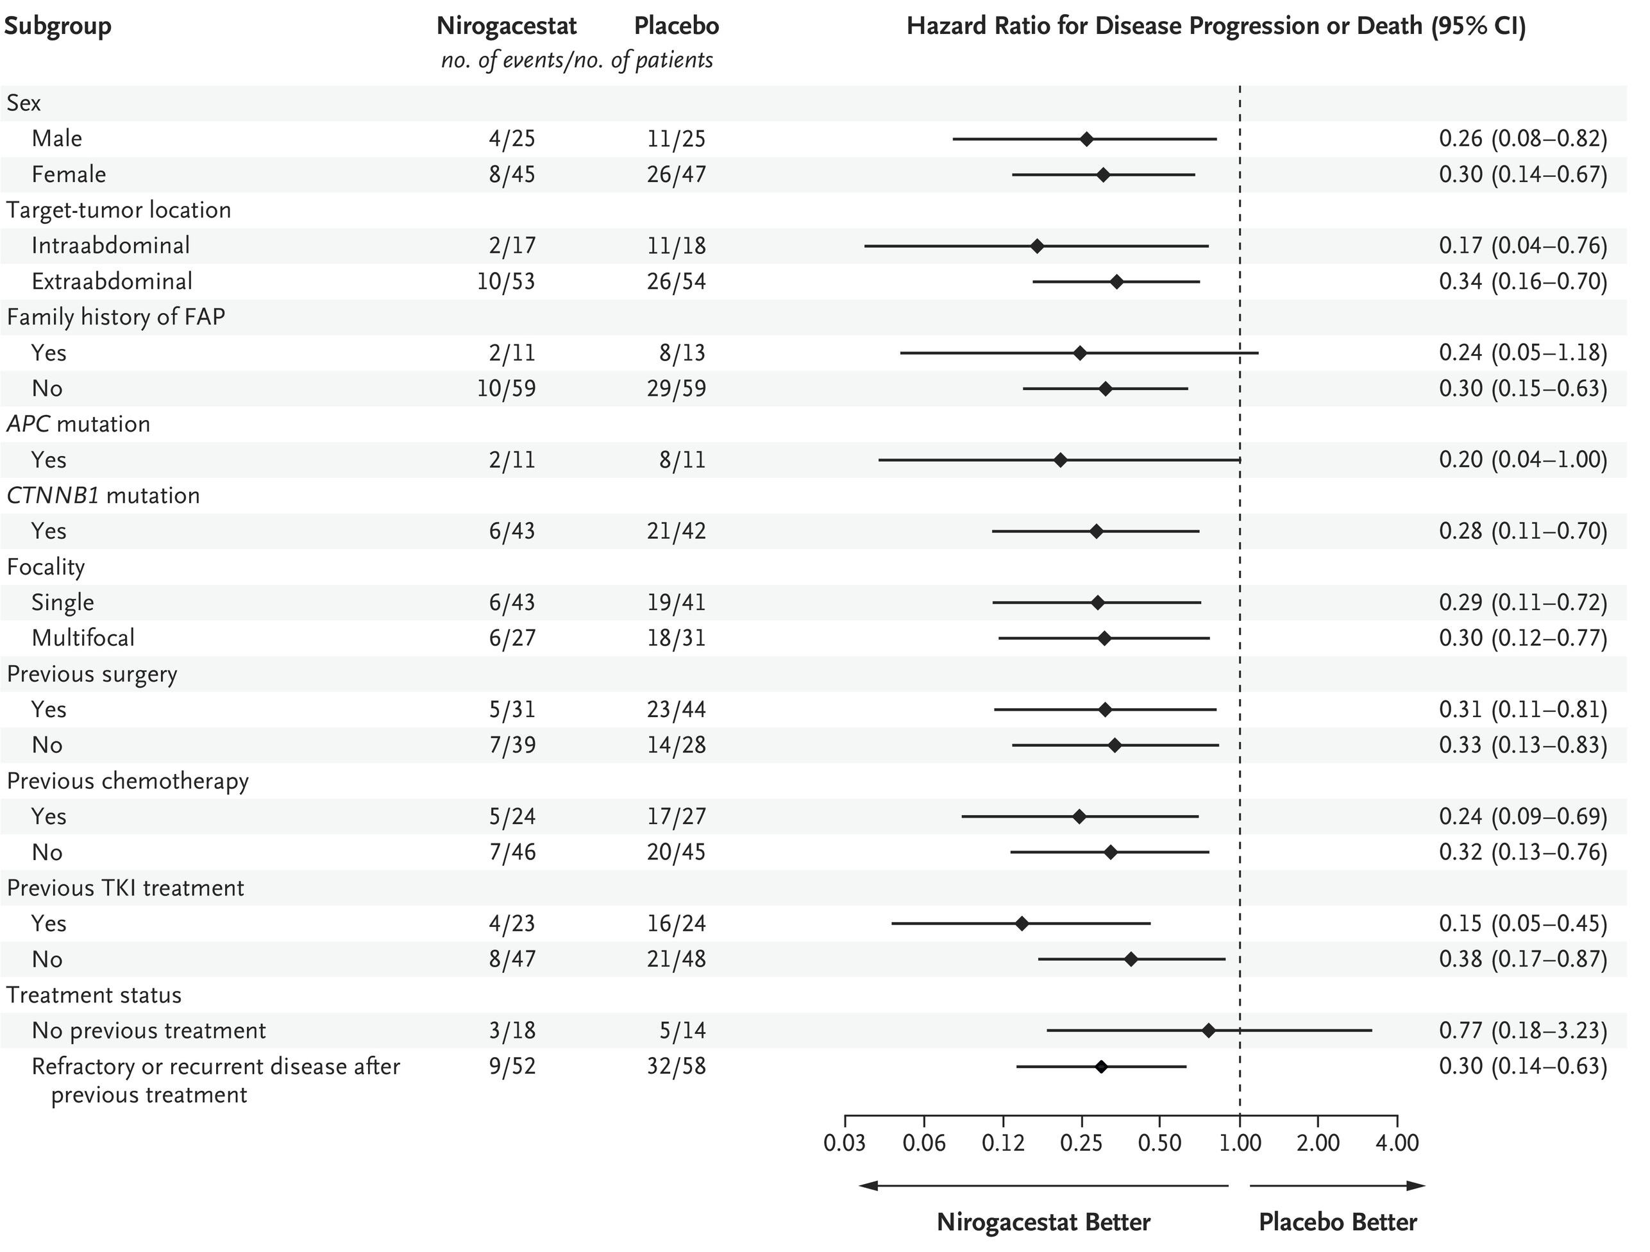
PFS Benefit With Nirogacestat Was Observed
Across Pre-specified Subgroups
Gounder M et al. NEJM 2023

Slide 58
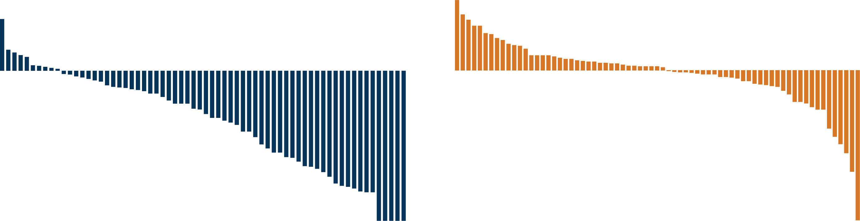
Nirogacestat Resulted in Substantial Reductions in Tumor Size
Nirogacestat
Placebo
Change in Tumor Size, %
ª

Slide 59
Nirogacestat Significantly Reduced Pain
Brief Pain Inventory Short Form: Worst Pain Intensity
LS Mean (SE) | Nirogacestat | Placebo | Difference
Cycle 10 | -1.5 (0.3) | -0.04 (0.3) | -1.5 P < .001
Nirogacestat
Placebo
1.0
Worsening
LS Mean (95% CI) For Change
From Baseline
-1.0
-2.0
Improvement
Analysis Visit
Nirogacestat | 69 | 61 | 57 | 43 | 44 | 46 | 45 | 39 | 41 | 40 | 37 | 40 | 35 | 35 | 39 | 38 | 34 | 32 | 32 | 33 | 34 | 32 | 30 | 31 | 24
Placebo | 71 | 61 | 62 | 43 | 45 | 46 | 40 | 35 | 31 | 31 | 28 | 26 | 23 | 25 | 23 | 25 | 22 | 21 | 23 | 17 | 14 | 19 | 16 | 15 | 11
Notes:
LS, least squares.

Slide 60
Nirogacestat Significantly Reduced DT-Specific Symptom Severity
GODDESS DTSS: Total Symptom Score
LS Mean (SE) | Nirogacestat | Placebo | Difference
Cycle 10 | -1.2 (0.2) | 0.4 (0.2) | -1.6 P < .001
Nirogacestat
Placebo
1.0
Worsening
LS Mean (95% CI) For Change
From Baseline
-1.0
Improvement
-2.0
Analysis Visit
Nirogacestat | 69 | 61 | 57 | 44 | 45 | 47 | 45 | 40 | 41 | 40 | 38 | 40 | 35 | 35 | 39 | 38 | 34 | 33 | 34 | 33 | 35 | 32 | 31 | 31 | 25
Placebo | 71 | 61 | 62 | 43 | 45 | 46 | 40 | 35 | 31 | 32 | 28 | 26 | 23 | 25 | 23 | 25 | 22 | 21 | 23 | 17 | 14 | 19 | 16 | 16 | 11
Notes:
DT, desmoid tumor; DTSS, GODDESS DT Symptom Scale; GODDESS, GOunder/Desmoid Tumor Research Foundation DEsmoid Symptom/Impact Scale; LS, least squares.

Slide 61
Nirogacestat Safety Profile
Safety Population, n (%) | Nirogacestat (n = 69) |  | Placebo (n = 72)
Duration of study drug exposure, median (range), mo | 20.6 (0.3-33.6) |  | 11.4 (0.2-32.5)
Dose intensity, median (range), mg/d | 288.3 (169-300) |  | 300.0 (239-300)
 | Any Grade | Grade ≥3 | Any Grade | Grade ≥3
Any TEAE | 69 (100) | 39 (57) | 69 (96) | 12 (17)
TEAEs of any grade reported in ≥25% of patients in either arm
Diarrhea | 58 (84) | 11 (16) | 25 (35) | 1 (1)
Nausea | 37 (54) | 1 (1) | 28 (39) | 0
Fatigue | 35 (51) | 2 (3) | 26 (36) | 0
Hypophosphatemia | 29 (42) | 2 (3) | 5 (7) | 0
Rash, maculopapular | 22 (32) | 4 (6) | 4 (6) | 0
Headache | 20 (29) | 0 | 11 (15) | 0
Stomatitis | 20 (29) | 3 (4) | 3 (4) | 0
TEAEs leading to death | 0 |  | 1 (1)ª
Dose reductions due to TEAEs | 29 (42) |  | 0
Discontinuations due to TEAEs | 14 (20)^{b} |  | 1 (1)^{b}
95% of TEAEs were grade 1 or 2; the first onset of TEAEs in most patients occurred during cycle 1
Notes:
TEAE, treatment-emergent adverse event.

Slide 62
Frequency and Resolution of Ovarian Dysfunction
Observed With Nirogacestat
OD is a composite AE associated
with changes in female reproductive hormone levels and clinical manifestations^{2,3}
Protocol-mandated serum hormone collection at baseline and cycles 1, 2,
4, and every 3 thereafter
Among women of childbearing potential, OD was observed in 75% receiving nirogacestat and 0% receiving placebo
  Median time to first onset of OD:
  8.9 weeks
  Median duration of OD events:
  21.3 weeks
27 of 36 women of childbearing potential reported OD
(75%)
11 patients discontinued nirogacestat for
any reason
(41%)
14 patients ongoing nirogacestat treatment
(52%)
2 patients
lost to follow-up after discontinuing nirogacestat
(7%)
OD resolved^{c} in 11 patients
(100%)
OD resolved^{c} in 9 patients
(64%)
Unresolved OD in 5 patients
(36%)
OD status unknown
OD, ovarian dysfunction
1. Thurston et al. Obstet Gynecol Clin North Am. 2011;38:489-501.
2. Mauri et al. Front Endocrinol (Lausanne). 2020;11:572388.
3. Kasper B et al. ESMO 2022. Abstract LBA2.
Notes:
OD, ovarian dysfunction.
1. Thurston et al. Obstet Gynecol Clin North Am. 2011;38:489-501. 2. Mauri et al. Front Endocrinol (Lausanne). 2020;11:572388.
1. Kasper B et al. ESMO 2022. Abstract LBA2.

Slide 63
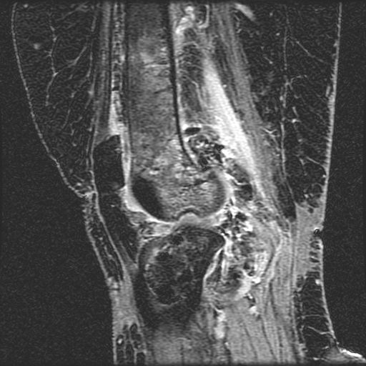
Diffuse-Type Tenosynovial Giant Cell Tumor
(Pigmented Villonodular Synovitis)
Notes:
In the remaining few minutes, I will discuss TGCT

Slide 64
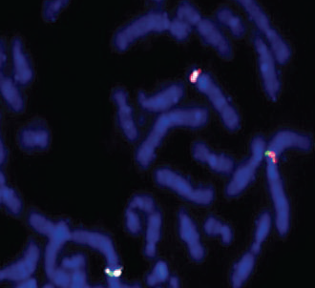
Pathogenesis of TGCT and Rationale for CSF1 Targeting
CSF1/COL6A3 translocation causes CSF-1 overexpression in a subpopulation of neoplastic cells, resulting in the recruitment of CSF-1 receptor-bearing inflammatory cells, leading to tumor formation¹
CSF-1
COL6A3
Overexpression of CSF1 mRNA
.
CSF1 gene < 77% in localized type and 75% in diffuse type²
CSF1 fusions result in the deletion of CSF1 exon 9, an important negative regulator of CSF-1 expression³
Notes:
-CME: new slide

Slide 65
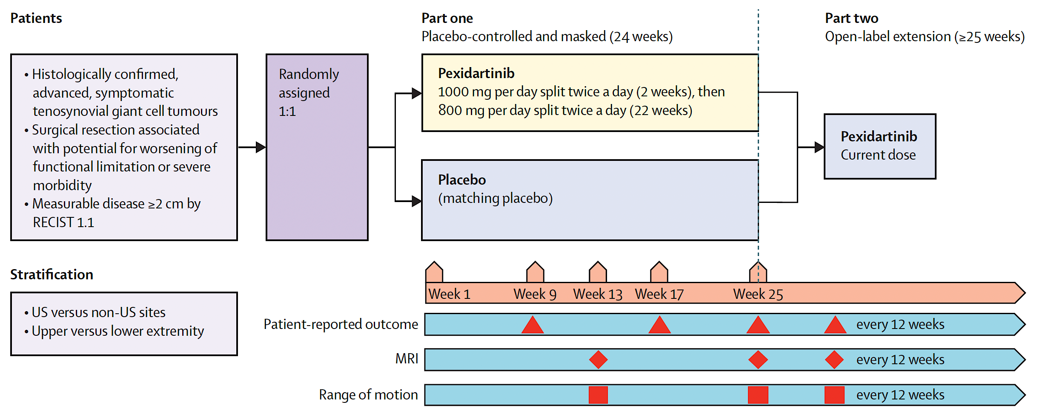
Phase III ENLIVEN Trial: Pexidartinib for Advanced TGCT¹

Slide 66
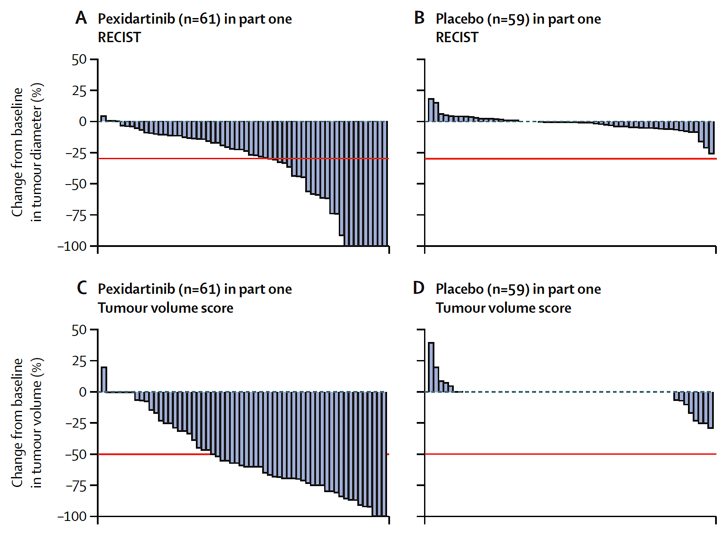
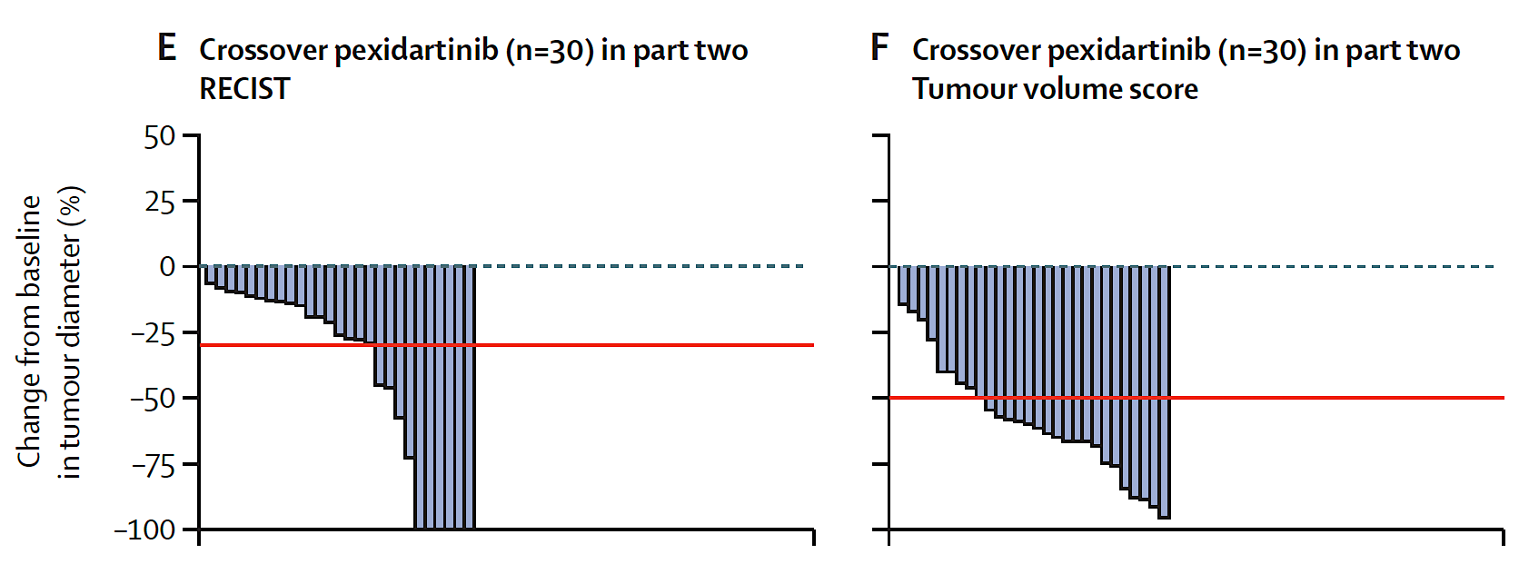
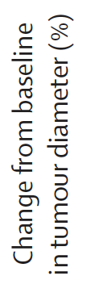
ENLIVEN: Response Based on Tumor Change From Baseline¹

Slide 67
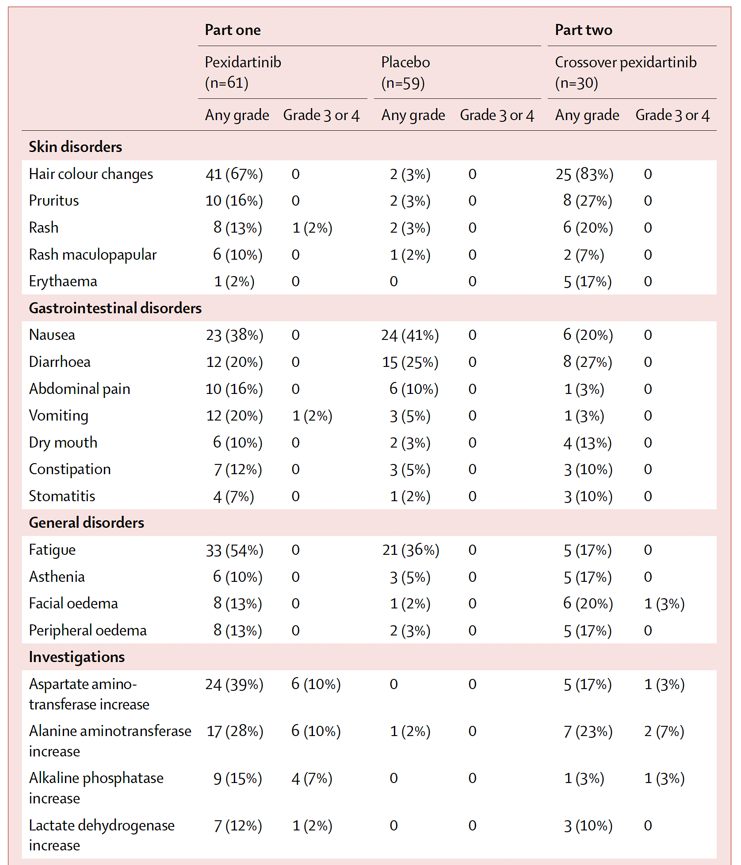
ENLIVEN: Selected Adverse Events of Interest¹

Slide 68
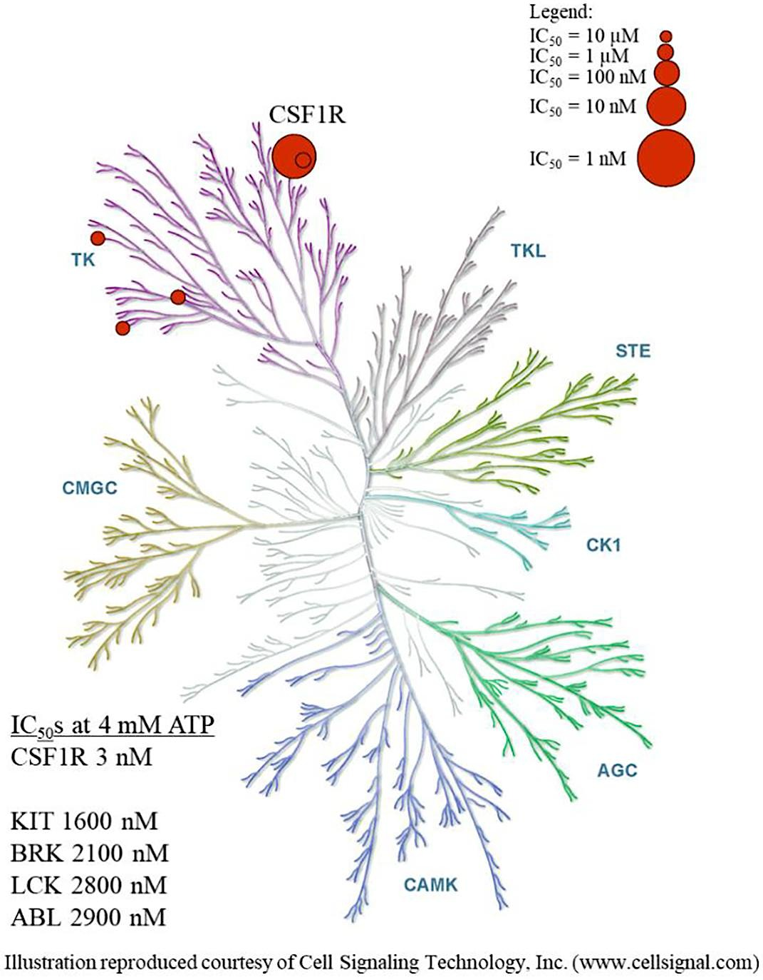
Vimseltinib is an Oral, Switch-Control TKI That Selectively and Potently Inhibits CSF1R
Caldwell TM et al. Bioorg Med Chem Lett. 2022 Oct 15:74:128928.

Slide 69
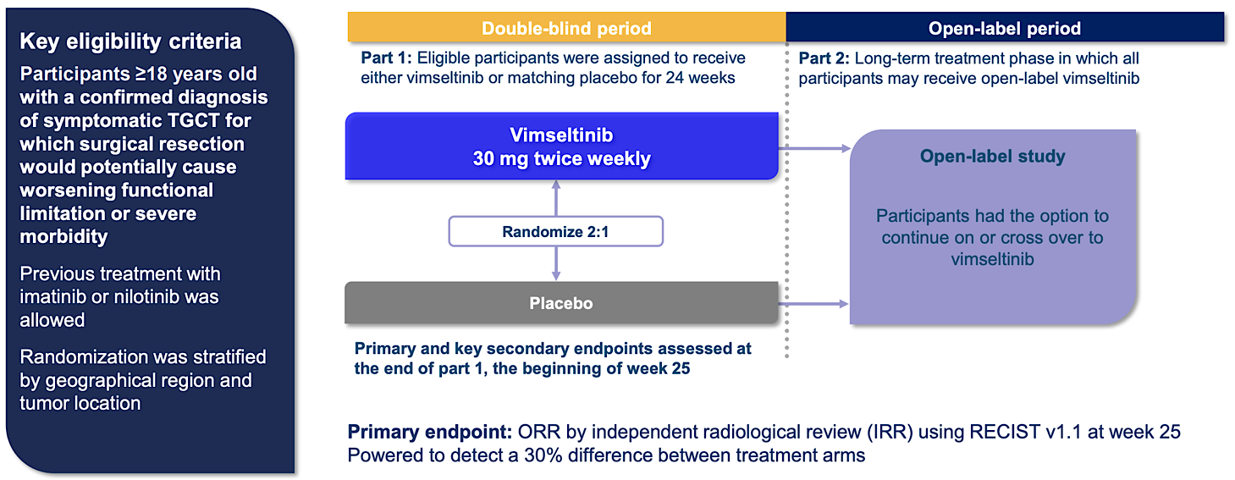
Phase 3 MOTION Study: Safety/Efficacy of Vimseltinib For TGCT Not Amenable to Surgical Resection

Slide 70
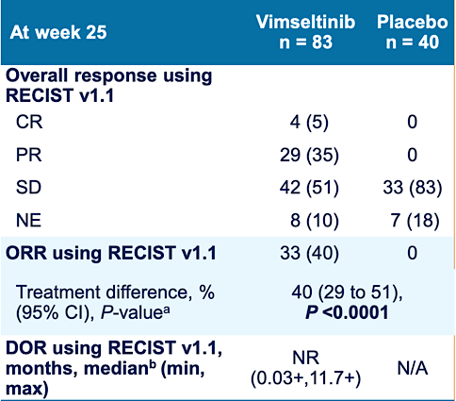
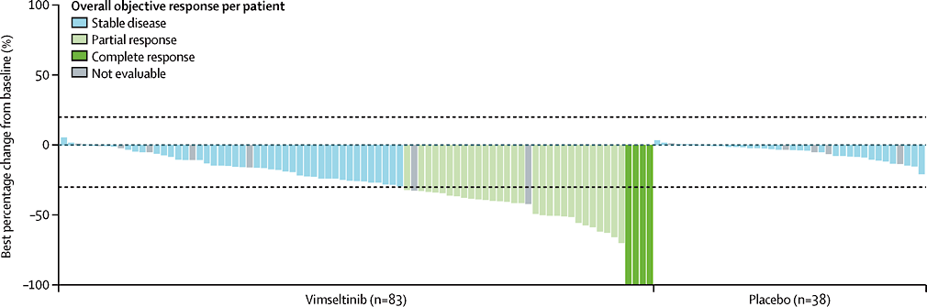
Phase 3 MOTION Trial: Vimseltinib Demonstrated Robust and Statistically Significant Antitumor Activity By RECIST v1.1
ORR per RECIST was 40% in the vimseltinib group vs 0% in the placebo group
(difference 40% [95% CI 29–51]; p<0·0001)
Tap WD et al. Future Oncol. 2024 Mar;20(10):593-601.
Gelderblom H et al. Lancet. 2024 Jun 22;403(10445):2709-2719.

Slide 71
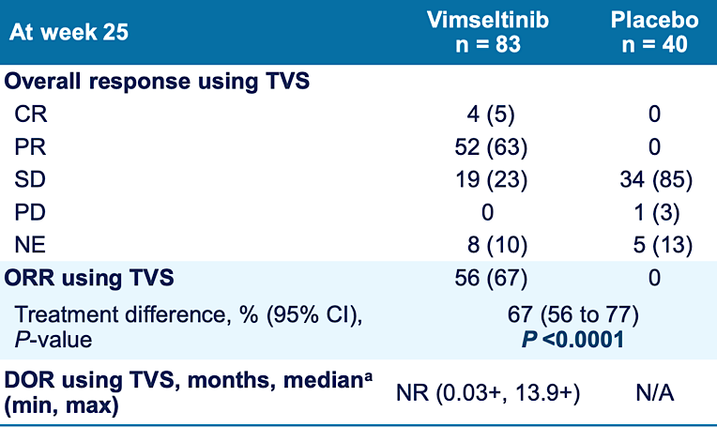
Phase 3 MOTION Trial: Vimseltinib Demonstrated Statistically Significant Antitumor Activity By Tumor Volume Score
The irregular growth and shape of TGCT can make measurement with linear methods, like RECIST, difficult
Tumor Volume Score (TVS) is a TGCT-specific semiquantitative MRI scoring system that estimates tumor volume
TVS response corresponds to ≥50% reduction in tumor volume
Response by TVS at week 25 may predict long-term response by RECIST
Tap WD et al. Future Oncol. 2024 Mar;20(10):593-601.
Gelderblom H et al. Lancet. 2024 Jun 22;403(10445):2709-2719.

Slide 72
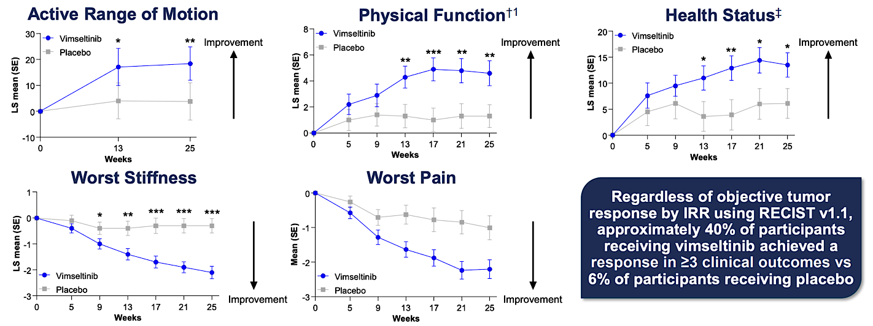
Patient-Reported Outcomes Showed That Vimseltinib Provided Early and Durable Functional and Symptomatic Improvements

Slide 73
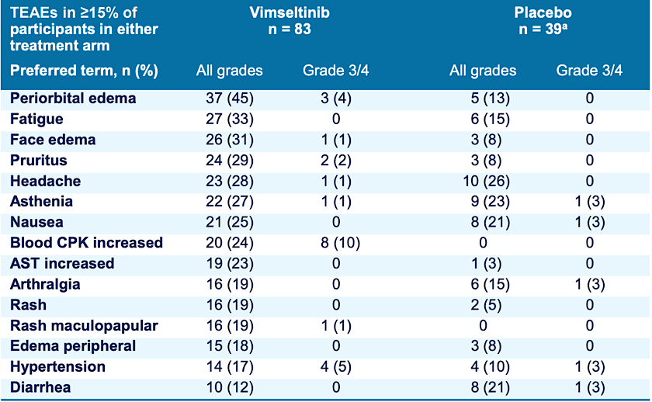
Vimseltinib Was Generally Well Tolerated With Few
Discontinuations Due to TEAEs
Most TEAEs were grade 1/2
Serum enzyme elevations were consistent with the known mechanism of action of CSF1R inhibitors
TEAEs led to treatment discontinuation in 6% of participants receiving vimseltinib
There was no evidence of cholestatic hepatotoxicity, drug-induced liver injury, or hair/skin hypopigmentation
Tap WD et al. Future Oncol. 2024 Mar;20(10):593-601.
Gelderblom H et al. Lancet. 2024 Jun 22;403(10445):2709-2719.

Slide 74
MANEUVER: A Phase 3, randomized, double-blind, placebo-controlled global study of pimicotinib in TGCT
Methods
Study design
Key eligibility criteria¹
Aged ≥18 years
Histologically confirmed unresectable TGCT
Measurable disease as defined by
RECIST v1.1 with at least one lesion
of ≥2 cm
Symptomatic disease because of active TGCTª
N=94^{b}
Part 1
Part 2
Part 3
Double blind
24 weeks²
Open label
24 weeks²
Open-label
extension^{d,2}
Pimicotinib (n=63)
Pimicotinib
Pimicotinib
50 mg QD,
oral
50 mg QD^{c},
oral
All patients,
entering Part 2 will receive open-label pimicotinib
50 mg QD^{c},
oral
R
2:1
Placebo (n=31)
The study is being conducted at 23 sites in China, 7 sites in Europe, and 10 sites in North America
Placebo
Stratification factor:
China vs non-China²

Slide 75
Pimicotinib resulted in substantial reductions in tumor size
Results
By the data cutoff, 58 of 63 patients (92.1%) in the pimicotinib group had a decrease in tumor size per BIRC based
on RECIST v1.1
Best percentage change from baseline for individual patients
Randomized to pimicotinib (n=63)
Randomized to placebo (n=31)
20
10
0
-10
-20
-30
Best percentage change from baseline in sum of the diameters of target lesions (%)
-40
-50
a
-60
-70
-80
-90
-100
Response status at Week 25
CR
PR
SD
PD
NE
Niu X et al. Future Oncol 2024;1–8

Slide 76
Pimicotinib demonstrated early improvements in relative ROM, worst pain, worst stiffness, and PROMIS-PF T-score
Results
Relative ROM LS mean CFB by visit
Worst stiffness NRS LS mean CFB by visit
30
**
1.0
*
*
**
25
0.5
*
*
*
20
*
0.0
15
-0.5
LS mean CFB (SE)
-1.0
LS mean CFB (SE)
10
-1.5
5
-2.0
0
-2.5
-5
-3.0
-10
-3.5
-4.0
Baseline
Week 13
Week 25
Baseline
Week 5
Week 9
Week 13
Week 17
Week 21
Week 25
BPI worst pain NRS LS mean CFB by visit
PROMIS-PF T-score LS mean CFB by visit
1.0
*
**
8
**
0.5
*
*
*
7
*
0.0
6
-0.5
5
LS mean CFB (SE)
4
LS mean CFB (SE)
-1.0
3
-1.5
2
-2.0
1
-2.5
0
-3.0
-1
-2
Baseline
Week 5
Week 9
Week 13
Week 17
Week 21
Week 25
Baseline
Week 5
Week 9
Week 13
Week 17
Week 21
Week 25
Treatment:
Placebo
Pimicotinib

Slide 77
Most frequent (≥20%) and class-specific TEAEs with pimicotinib
Results
Most common TEAEs (≥20%) by Week 25, n (%) | Pimicotinib​ n=63 |  | Placebo​ n=31
Preferred term​ | All grades​ | Grade 3/4​ | All grades​ | Grade 3/4​
Clinical AEs
Pruritus​ | 33 (52.4)​ | 2 (3.2)​ | 1 (3.2)​ | 0​
Face edema​ | 30 (47.6)​ | 0​ | 0​ | 0​
Rash​ | 22 (34.9)​ | 2 (3.2)​ | 0​ | 0​
Periorbital edema​ | 20 (31.7)​ | 0​ | 3 (9.7)​ | 0​
Fatigue​ | 18 (28.6)​ | 0​ | 7 (22.6)​ | 0​
Nausea​ | 17 (27.0)​ | 0​ | 2 (6.5)​ | 0​
Headache​ | 13 (20.6)​ | 0​ | 2 (6.5)​ | 0​
Most common TEAEs (≥20%) by Week 25, n (%) | Pimicotinib​ n=63 |  | Placebo​ n=31
Preferred term​ | All grades​ | Grade 3/4​ | All grades​ | Grade 3/4​
Laboratory AEsª
Blood CPK increased​ | 45 (71.4)​ | 8 (12.7)​ | 5 (16.1)​ | 0​
Blood LDH increased​ | 36 (57.1)​ | 0​ | 0​ | 0​
AST increased​ | 34 (54.0)​ | 0​ | 3 (9.7)​ | 0​
Amylase increased | 22 (34.9)​ | 0​ | 0​ | 0​
α-HBDH increased | 16 (25.4)​ | 0​ | 0​ | 0​
Lipase increased​ | 15 (23.8)​ | 2 (3.2)​ | 1 (3.2)​ | 0​
There was no evidence of hair/skin hypopigmentation
TEAEs of hypertension occurred in 14.3% of patients treated with pimicotinib (Grade 3, 3.2%)
In the pimicotinib arm, AST/ALT elevations were mainly Grade 1 (50.8%/15.9%; Grade 2 3.2%/1.6%), and there was no evidence of cholestatic hepatotoxicity or drug-induced liver injury
Niu X et al. Future Oncol 2024;1–8

Slide 78
Landscape of published phase III trials
Trials | ENLIVEN (n=100) ¹ | MOTION (n=123) ² | MANEUVER (n=94) ³
TKI | Pexidartinib | Vimseltinib | Pimicotinib
ORR at wk 24 [95%-CI] | 39% [28-52%] | 40% [29-51%] | 54% [32-66%]
R of Motion Stiffness Pain | Yes Yes No | Yes Yes Yes | Yes Yes Yes
Grade ≥3 [95%-CI] | 44% [30-59%] | 37% [27-48%] | 35% [24-48%]
Dose reduction [95%-CI] | 38% [19-46%] | 44% [33-55%] | 8% [2-17%]
Discontinuation [95%-CI] | 13% [4-24%] | 6% [2-13%] | 2% [0-8%]
(1) – Tap et al. Lancet. 2019; (2) – Gelderblom et al. Lancet Oncol 2024; (3) Niu et al. ASCO 2025
PENEL Nicolas – TIKIN Away. ASCO 2025

Slide 79
Grade≥3 toxicities in the context of benign tumour
CPK increase: 13%
Rash: 3%
Pruritis: 3%
Lipase increase: 3%
Rule out
Rhabdomyolysis and
Myocardial infarction
Trials | ENLIVEN (n=100) ¹ | MOTION (n=123) ² | MANEUVER (n=94) ³
TKI | Pexidartinib | Vimseltinib | Pimicotinib
Grade≥3 CPK increase | Not reported | 10% | 13%
⁽¹⁾ – Tap et al. Lancet. 2019; ⁽²⁾ – Gelderblom et al. Lancet Oncol 2024; ⁽³⁾ Niu et al. ASCO 2025
PENEL Nicolas – TIKIN Away. ASCO 2025

Slide 80
Management of tenosynovial giant cell tumor
TGCT
Asymptomatic disease
Symptomatic disease
Active surveillance
NSAID, Painkillers …
Targeted therapies
  Vimseltinib (FDA: Yes/EMA: Yes)
  Pimicotinib … ASAP ?
  Pexidartinib (FDA: Yes/EMA: No)
Adapted from Stacchiotti S et al. Cancer Treat Rev. 2023
PENEL Nicolas – TIKIN Away. ASCO 2025

Slide 81
Agenda
Introduction: Current Role of General Medical Oncologists in the Treatment of Soft Tissue Sarcomas (STS)
Module 1: Incorporation of Novel Agents and Strategies into the Management of STS — Faculty Presentation
Module 2: Incorporation of Novel Agents and Strategies into the Management of STS — Survey Questions
Module 3: Evolving Treatment Paradigm for Locally Aggressive STS
— Faculty Presentation
Module 4: Evolving Treatment Paradigm for Locally Aggressive STS
— Survey Questions
Module 5: ASCO 2025

Slide 82
Questions from General Medical Oncologists —
Desmoid Tumors: Observation vs treatment
Often patients are initially observed. When do you decide to initiate therapy?
When to observe desmoid tumors?
Would you ever consider surgery in desmoid tumors upfront?
How effective is radiation therapy for desmoid tumors as a therapeutic modality? What about as palliation?
Do you send all your patients with desmoid tumors for genetic counseling?

Slide 83
Questions from General Medical Oncologists —
Desmoid Tumors: Systemic Treatment
How effective is liposomal doxorubicin in the treatment of desmoid tumors?
How does approval of nirogacestat change approach to upfront surgery vs drug therapy?
Is nirogacestat being studied in a perioperative setting for patients with desmoid tumor, especially those with intraabdominal sites that are not easily amenable for surgery?

Slide 84
Questions from General Medical Oncologists —
Desmoid Tumors: Nirogacestat
19-year-old woman with symptomatic pelvic desmoid tumor x 5 years relatively stable on low dose sorafenib on and off but now larger with more pain. What do you recommend next? If you decide to give nirogacestat, what do you advise her regarding ovarian function? What about upfront egg harvesting?
How to manage use in premenopausal patients about to start nirogacestat regarding ovarian dysfunction?

Slide 85
Questions from General Medical Oncologists —
Desmoid Tumors: Nirogacestat
What patient or tumor characteristics make someone a good candidate for nirogacestat, and how does this therapy compare with prior approaches in terms of tolerability and impact on symptom burden?
How do you manage diarrhea with nirogacestat? Dose reduction, loperamide, octreotide?
How best to manage AEs? I had a patient stop treatment due to AEs.

Slide 86
Questions from General Medical Oncologists —
TGCT: CSF1R Inhibitors
What are the key similarities and differences among available and experimental CSF1R inhibitors for treating TGCT, and how do these factors influence your choice of agent and management strategy?
How do you choose between vimseltinib and pexidartinib?
Have you used either agent in the neoadjuvant setting? What about the adjuvant setting?

Slide 87
Questions from General Medical Oncologists —
TGCT: CSF1R Inhibitors
Any difference in vimseltinib and pexidartinib in terms of response and outcome between the nodular and the diffuse types of TGCT?
Any other TKIs that are effective treating TGCT?
How often do you manage liver function with pexidartinib?

Slide 88
Questions from General Medical Oncologists —
Afamitresgene autoleucel
Are the toxicities secondary to T-cell receptor gene therapy afamitresgene autoleucel for patients similar to CAR T cell therapy? What unique post-therapy AEs should physicians be mindful of in the community setting among those treated with this novel therapy?
In patients with advanced synovial sarcoma w/ MAGE-A4 expression, who receive afamitresgene autoleucel therapy at an academic cancer center, how do you manage long-term complications in a small community practice when the patient returns?
The T-cell receptor gene therapy is a new modality of treatment, so would appreciate information on diagnosis, staging, and treatment algorithms.
What tox profile and can it be done in community or academic center?

Slide 89
Questions from General Medical Oncologists —
Advanced STS: Sequencing of agents
Second-line treatment of a malignant peripheral nerve sheath tumor after progression on doxorubicin ifosfamide/ifosfamide etoposide for 8 courses of treatment total (ECOG 0, age 45)?
Besides chemotherapy what other options are available? I have a patient with recurrent sarcoma that is going to be treated with a thermal IR procedure in his lungs that is thought to develop more TLS formation - is there a role for PD1/CTLA4 inhibition?

Slide 90
Agenda
Introduction: Current Role of General Medical Oncologists in the Treatment of Soft Tissue Sarcomas (STS)
Module 1: Incorporation of Novel Agents and Strategies into the Management of STS — Faculty Presentation
Module 2: Incorporation of Novel Agents and Strategies into the Management of STS — Survey Questions
Module 3: Evolving Treatment Paradigm for Locally Aggressive STS
— Faculty Presentation
Module 4: Evolving Treatment Paradigm for Locally Aggressive STS
— Survey Questions
Module 5: ASCO 2025

Slide 91
Pimicotinib in tenosynovial giant cell tumor (TGCT): Efficacy, safety and patient-reported outcomes of phase 3 MANEUVER study.
Niu X et al
ASCO 2025; Abstract 11500
Anlotinib in combination with epirubicin followed by maintenance anlotinib versus placebo plus epirubicin as first-line treatment for advanced soft tissue sarcoma (STS): A randomized, double-blind, parallel-controlled, phase III study.
Zhou Y et al.
ASCO 2025; Abstract 11501
Eribulin plus anlotinib in advanced soft tissue sarcoma (ERAS): Updates on efficacy and biomarkers.
Deng Y et al
ASCO 2025; Abstract 11502
ASCO 2025 | ORAL ABSTRACT SESSION

Slide 92
Off-label use of fam-trastuzumab deruxtecan in desmoplastic small round cell tumor.
Slotkin ES et al.
ASCO 2025; Abstract 11504
A randomized phase III trial of catequentinib hydrochloride (AL3818) versus placebo in subjects with metastatic or advanced leiomyosarcoma (LMS).
Jones RL et al.
ASCO 2025; Abstract 11506
Alliance A092104: A randomized phase 2/3 study of olaparib plus temozolomide versus investigator’s choice for the treatment of patients with advanced uterine leiomyosarcoma after progression on prior chemotherapy.
Van Tine BA et al.
ASCO 2025; Abstract 11507.
ASCO 2025 | ORAL ABSTRACT SESSION

Slide 93
Detecting ctDNA using personalized structural variants to forecast recurrence in localized soft tissue sarcoma (STS).
Park CL et al.
ASCO 2025; Abstract 11511
Phase II of sunitinib plus nivolumab in extraskeletal myxoid chondrosarcoma: Results from the GEIS, ISG, and UCL IMMUNOSARC II Study.
Hindi N et al.
ASCO 2025; Abstract 11513
ImmunoSarc2 (Cohort 7a): A Spanish Sarcoma Group (GEIS) phase Ib trial of epirubicin and ifosfamide plus nivolumab in first line of advanced undifferentiated pleomorphic sarcoma (UPS).
Broto JM et al
ASCO 2025; Abstract 11514 .
ASCO 2025 | ORAL ABSTRACT SESSION

Slide 94
A phase 2 study using metronomic gemcitabine, doxorubicin, and docetaxel plus nivolumab in advanced leiomyosarcoma and liposarcoma (NCT04535713).
Ballon J et al.
ASCO 2025; Abstract 11515
Subgroup analysis of the phase 2 part of the RINGSIDE phase 2/3 trial of varegacestat for treatment of desmoid tumors.
Chugh R et al.
ASCO 2025; Abstract 11516
ASCO 2025 | ORAL ABSTRACT SESSION

Slide 95
Long-term clinical outcome assessments in patients with tenosynovial giant cell tumor treated with vimseltinib: 1-year results from the MOTION phase 3 trial
Bhadri VA et al.
ASCO 2025; Abstract 11558
Change in T2-weighted signal intensity, change in tumor volume, and exposure-response analysis in the RINGSIDE phase 2 study of varegacestat in patients with desmoid tumors
Gounder M et al.
ASCO 2025; Abstract 11557
A phase 3, randomized, double-blind, placebo-controlled study to assess the efficacy and safety of emactuzumab in patients with tenosynovial giant cell tumor (TANGENT).
Gelderblom H et al.
ASCO 2025; Abstract TPS11584
ASCO 2025 | POSTER SESSION

Slide 96
Thank you for joining us!
Please take a moment to complete the survey currently up on Zoom. Your feedback is very important to us. The survey will remain open for 5 minutes after the meeting ends.
Information on how to obtain CME credit is provided in the Zoom chat room.
Attendees will also receive an email in
1 to 3 business days with these instructions.

