Slide 1
RTP Live from Chicago: Investigator Perspectives on Available Research Findings and Challenging Questions in the Management of Renal Cell Carcinoma
Monday, June 2, 2025 7:00 AM – 8:00 AM CT (8:00 AM – 9:00 AM ET)
Faculty
Professor Laurence Albiges, MD, PhD
Tian Zhang, MD, MHS
Moderator
Neil Love, MD

Slide 2
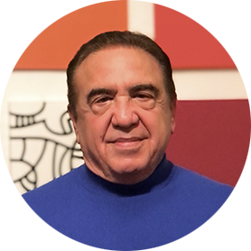
Faculty
Professor Laurence Albiges, MD, PhD
Medical Oncologist
Chair, Medical Oncology Department
Gustave Roussy Cancer Center
Villejuif, France
MODERATOR
Neil Love, MD Research To Practice Miami, Florida
Tian Zhang, MD, MHS
Associate Professor
Director of Clinical Research
Division of Hematology and Oncology
Department of Internal Medicine
UT Southwestern Medical Center
Associate Director for Clinical Research
Simmons Comprehensive Cancer Center
Dallas, Texas

Slide 3
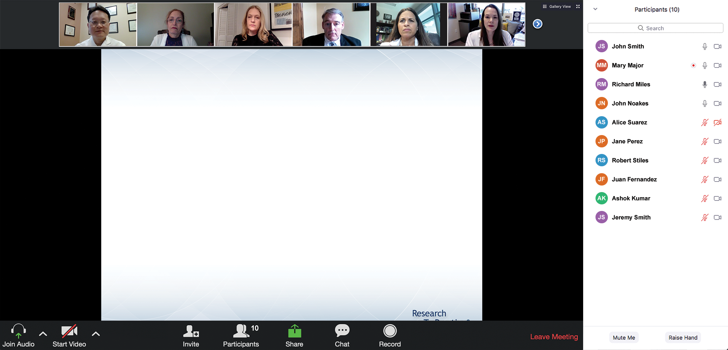
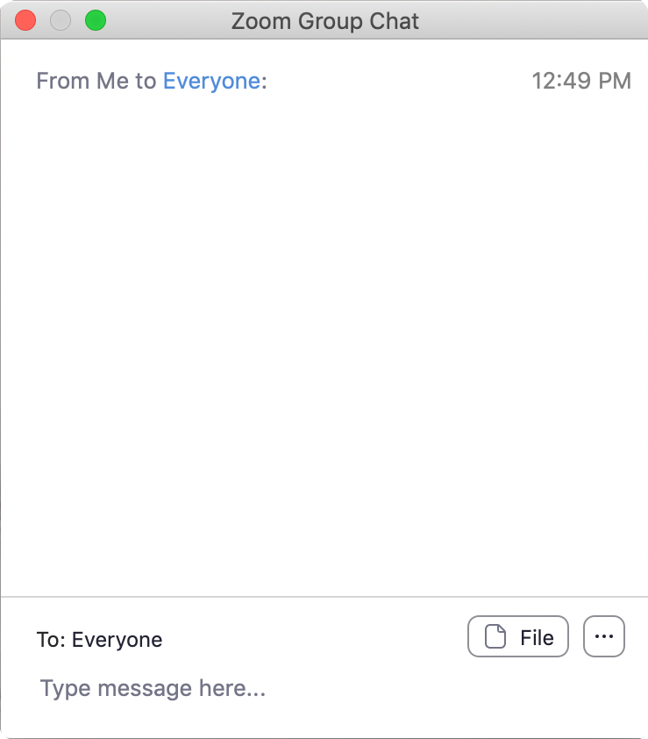
We Encourage Clinicians in Practice to Submit Questions
Feel free to submit questions now before the program begins and throughout the program.

Slide 4
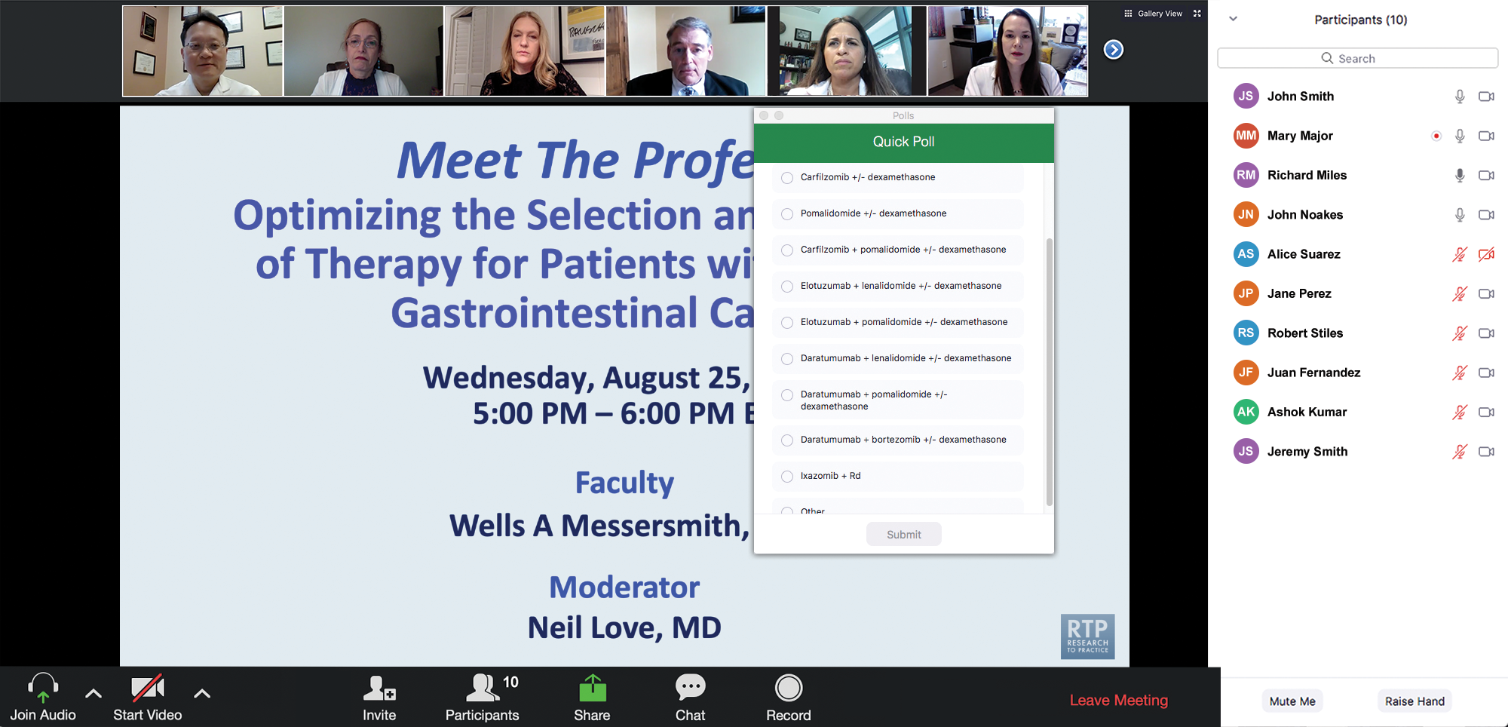
Clinicians in the Audience, Please Complete the Pre- and Postmeeting Surveys
Quick Survey
Quick Poll

Slide 5
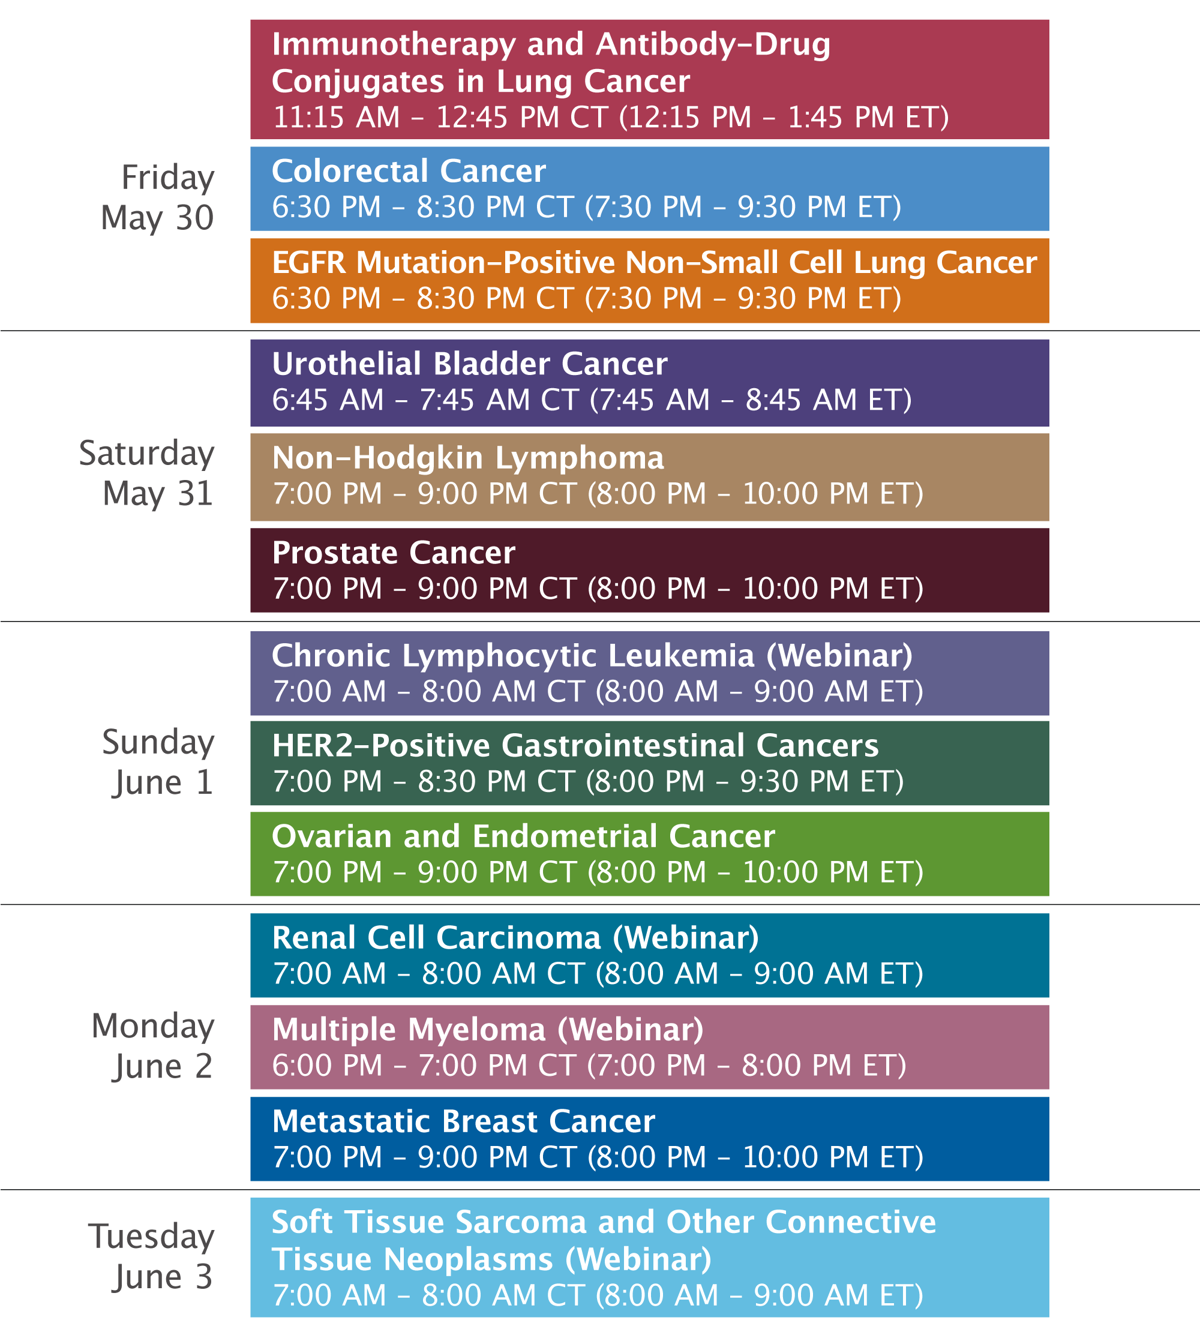

Slide 6
RTP Live from Chicago: Investigator Perspectives on Available Research Findings and Challenging Questions in the Management of Renal Cell Carcinoma
Monday, June 2, 2025 7:00 AM – 8:00 AM CT (8:00 AM – 9:00 AM ET)
Faculty
Professor Laurence Albiges, MD, PhD
Tian Zhang, MD, MHS
Moderator
Neil Love, MD

Slide 7
Prof Albiges — Disclosures Faculty
Advisory/Consulting/Honoraria (All Paid to Institution) | Amgen Inc, Astellas, AstraZeneca Pharmaceuticals LP, Bristol Myers Squibb, Daiichi Sankyo Inc, Eisai Inc, Ipsen Biopharmaceuticals Inc, Janssen Biotech Inc, Merck, MSD, Novartis, Pfizer Inc, Roche Laboratories Inc, Telix Pharmaceuticals Limited, Xencor.

Slide 8
Dr Zhang — Disclosures Faculty
Advisory Committees | Amgen Inc, AstraZeneca Pharmaceuticals LP, Aveo Pharmaceuticals, Bayer HealthCare Pharmaceuticals, Bristol Myers Squibb, Dendreon Pharmaceuticals Inc, Eisai Inc, EMD Serono Inc, Exelixis Inc, Gilead Sciences Inc, Janssen Biotech Inc, Lilly, Merck, Novartis, Pfizer Inc, Sanofi
Consulting Agreements | Aptitude Health, DAVA Oncology, Pfizer Inc, Vaniam Group
Contracted Research | ALX Oncology, Astellas, AstraZeneca Pharmaceuticals LP, Bayer HealthCare Pharmaceuticals, Exelixis Inc, Janssen Biotech Inc, Janux Therapeutics, Lilly, Merck, OncoC4, Pfizer Inc, Tempus
Nonrelevant Financial Relationships | Mashup Media LLC, MJH Life Sciences, PeerView

Slide 9
Dr Love — Disclosures
Dr Love is president and CEO of Research To Practice. Research To Practice receives funds in the form of educational grants to develop CME activities from the following companies: Aadi Bioscience, AbbVie Inc, ADC Therapeutics, Alexion Pharmaceuticals, Amgen Inc, Array BioPharma Inc, a subsidiary of Pfizer Inc, Arvinas, Astellas, AstraZeneca Pharmaceuticals LP, Aveo Pharmaceuticals, Bayer HealthCare Pharmaceuticals, BeiGene Ltd, Black Diamond Therapeutics Inc, Blueprint Medicines, Boehringer Ingelheim Pharmaceuticals Inc, Bristol Myers Squibb, Clovis Oncology, Coherus BioSciences, CTI BioPharma, a Sobi Company, Daiichi Sankyo Inc, Eisai Inc, Elevation Oncology Inc, Exact Sciences Corporation, Exelixis Inc, Genentech, a member of the Roche Group, Genmab US Inc, Geron Corporation, Gilead Sciences Inc, GSK, Hologic Inc, ImmunoGen Inc, Incyte Corporation, Ipsen Biopharmaceuticals Inc, Jazz Pharmaceuticals Inc, Johnson & Johnson, Karyopharm Therapeutics, Kite, A Gilead Company, Kura Oncology, Legend Biotech, Lilly, MEI Pharma Inc, Merck, Mersana Therapeutics Inc, Mirati Therapeutics Inc, Mural Oncology Inc, Natera Inc, Novartis, Novartis Pharmaceuticals Corporation on behalf of Advanced Accelerator Applications, Novocure Inc, Nuvalent, Pfizer Inc, Pharmacyclics LLC, an AbbVie Company, Puma Biotechnology Inc, Regeneron Pharmaceuticals Inc, Rigel Pharmaceuticals Inc, R-Pharm US, Sanofi, Seagen Inc, Servier Pharmaceuticals LLC, SpringWorks Therapeutics Inc, Stemline Therapeutics Inc, Syndax Pharmaceuticals, Taiho Oncology Inc, Takeda Pharmaceuticals USA Inc, TerSera Therapeutics LLC, and Tesaro, A GSK Company.

Slide 10
Commercial Support
This activity is supported by educational grants from Aveo Pharmaceuticals and Exelixis Inc.
Research To Practice CME Planning Committee Members, Staff and Reviewers
Planners, scientific staff and independent reviewers for Research To Practice have no relevant conflicts of interest to disclose.

Slide 11
This educational activity contains discussion of non-FDA-approved uses of agents and regimens. Please refer to official prescribing information for each product for approved indications.

Slide 12
Agenda
Introduction: Adjuvant Immunotherapy for Localized Renal Cell Carcinoma (RCC)
Module 1: Metastatic Clear Cell RCC — Faculty Presentation
Module 2: Metastatic Clear Cell RCC — Survey Questions
Module 3: Non-Clear Cell RCC — Faculty Presentation
Module 4: Non-Clear Cell RCC — Survey Questions
Module 5: ASCO 2025

Slide 13
Agenda
Introduction: Adjuvant Immunotherapy for Localized Renal Cell Carcinoma (RCC)
Module 1: Metastatic Clear Cell RCC — Faculty Presentation
Module 2: Metastatic Clear Cell RCC — Survey Questions
Module 3: Non-Clear Cell RCC — Faculty Presentation
Module 4: Non-Clear Cell RCC — Survey Questions
Module 5: ASCO 2025

Slide 14
Survey of 50 Community-Based General Medical Oncologists
May 14-24, 2025

Slide 17
Questions from General Medical Oncologists — Adjuvant Immunotherapy for Localized RCC
We have difficulties coordinating multidisciplinary management with urology and radiation oncology, including limited referrals from urology for patients with early-stage RCC who can qualify for adjuvant pembrolizumab.
Insurance authorization is often a time-consuming hassle. Even when finally approved, there can be a delay in initiating therapy, which creates anxiety for both the patient and for the provider as well.

Slide 18
Questions from General Medical Oncologists — Adjuvant Immunotherapy for Localized RCC
Is there a specific online risk calculator that you recommend to assist in estimating the risk of recurrence, and if yes, what level of risk do you feel justifies adjuvant therapy?
Do you recommend adjuvant pembrolizumab for patients with oligometastatic disease who have completed local therapy to all sites of disease?
Any trials adding oral TKIs to IOs? CTLA-4 plus PD-1?

Slide 19
Adjuvant Pembrolizumab ± Tivozanib: Phase III STRIKE Study
Tivozanib + Pembrolizumab
Key Inclusion Criteria:
High-risk RCC with clear cell component with or without sarcomatoid features
Complete resection of the primary tumor (radical or partial nephrectomy)
R
(N = 1040)
Pembrolizumab monotherapy
ClinicalTrials Identifier: NCT06661720. Accessed June 2025.

Slide 20
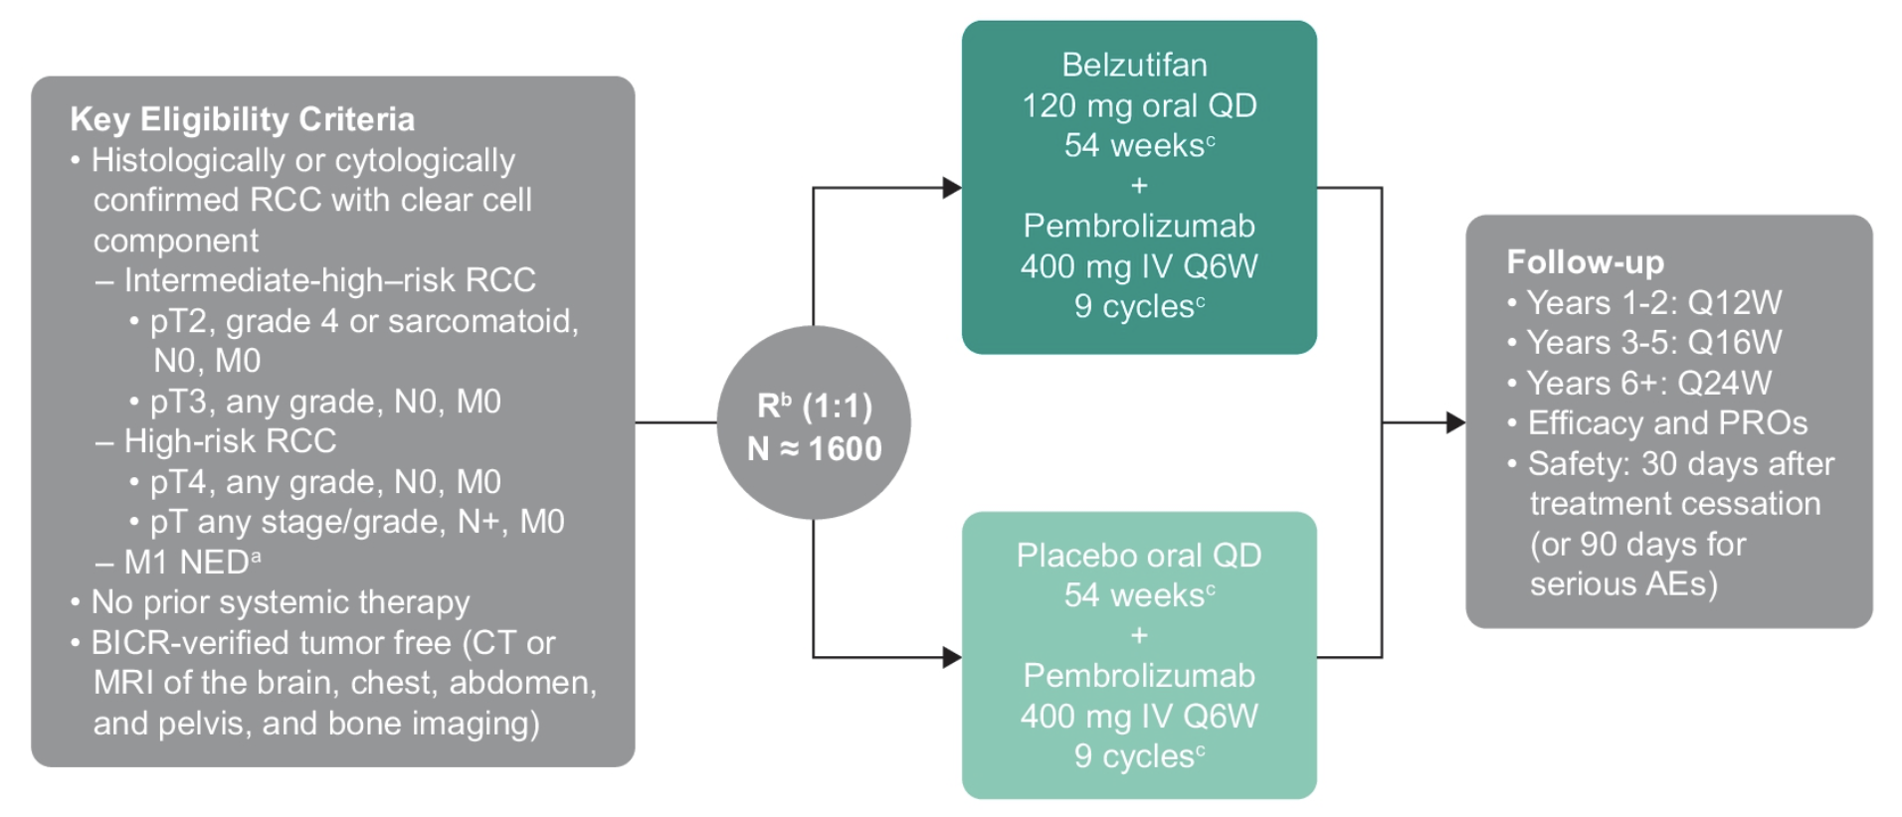
Adjuvant Pembrolizumab ± Belzutifan: Phase III LITESPARK-022 Study
Choueiri T et al. ASCO GU 2023;Abstract TPS748.

Slide 21
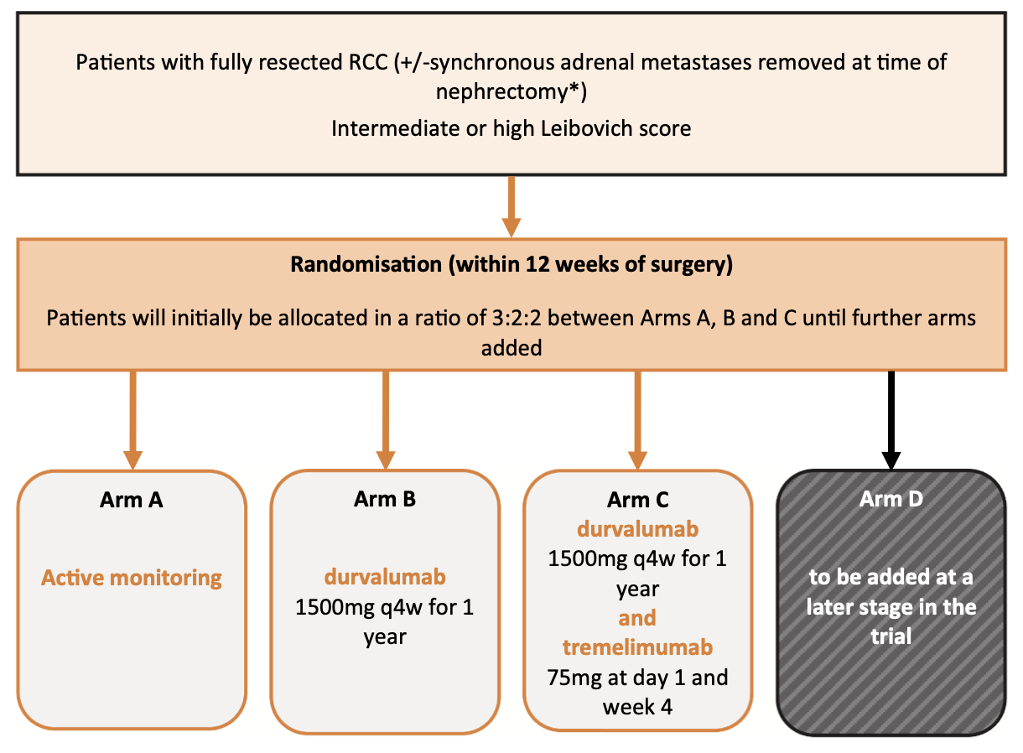
Adjuvant Durvalumab ± Tremelimumab: Phase III RAMPART Study
Oza B et al. Contemp Clin Trials 2021;108:106482.

Slide 22
Agenda
Introduction: Adjuvant Immunotherapy for Localized Renal Cell Carcinoma (RCC)
Module 1: Metastatic Clear Cell RCC — Faculty Presentation
Module 2: Metastatic Clear Cell RCC — Survey Questions
Module 3: Non-Clear Cell RCC — Faculty Presentation
Module 4: Non-Clear Cell RCC — Survey Questions
Module 5: ASCO 2025

Slide 23
Management of metastatic renal cell carcinoma: from front line to refractory treatments
Tian Zhang, MD, MHS
Associate Professor
Associate Director of Clinical Research
Simmons Comprehensive Cancer Center
UT Southwestern Medical Center
Research To Practice
June 2, 2025

Slide 24
Modifying disease biology after treatment
Disease detection/
IMDC prognostication
1st line metastatic
Treatment start
Early localized
disease
Metastatic
disease
Refractory/resistant disease
Palliative intent
Increasing tumor burden
Aggressive/
inflammatory
Disease
Refractory disease occurs after
first-line immunotherapy doublets
Good prognosis
Intermed prognosis
Poor prognosis
Adapted T. Powles KCRS 2023
Tian Zhang, MD, MHS

Slide 25
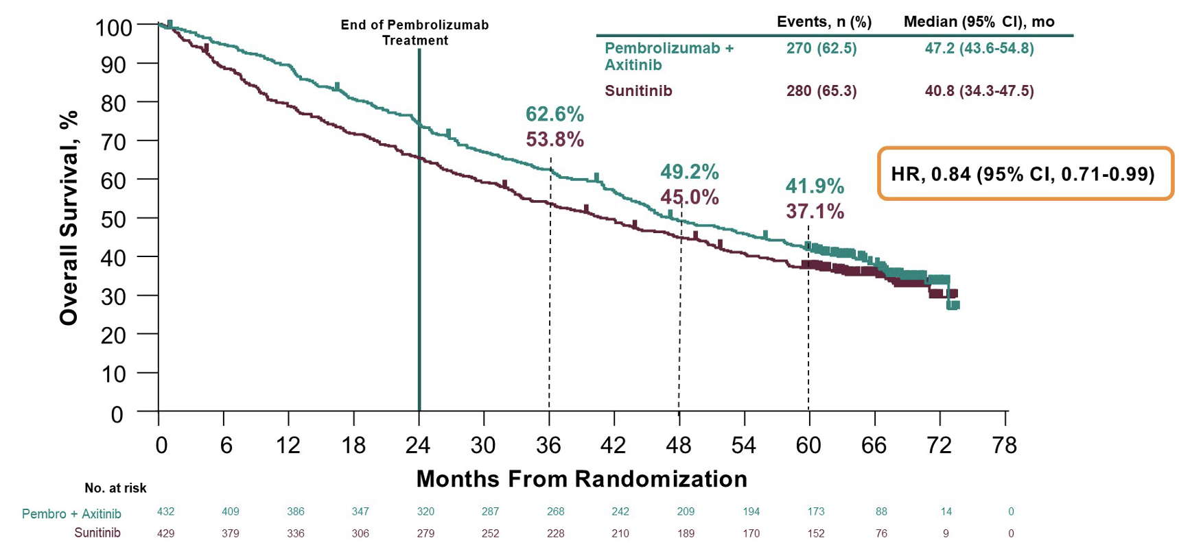
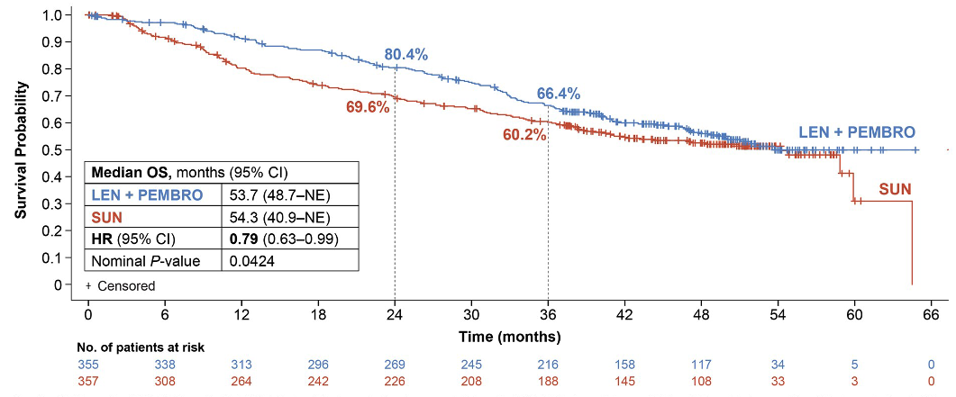
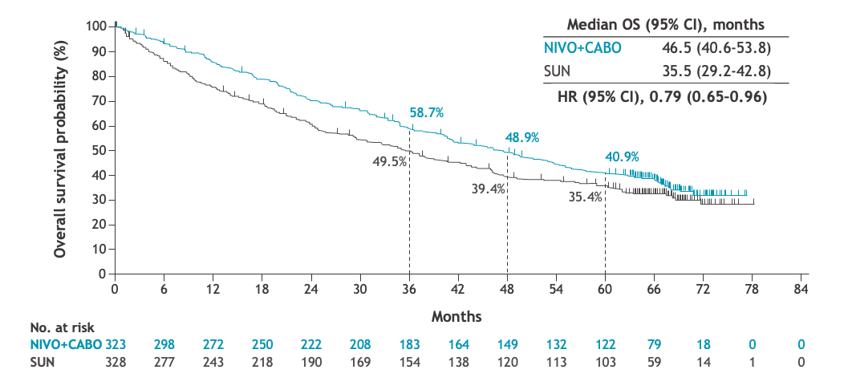
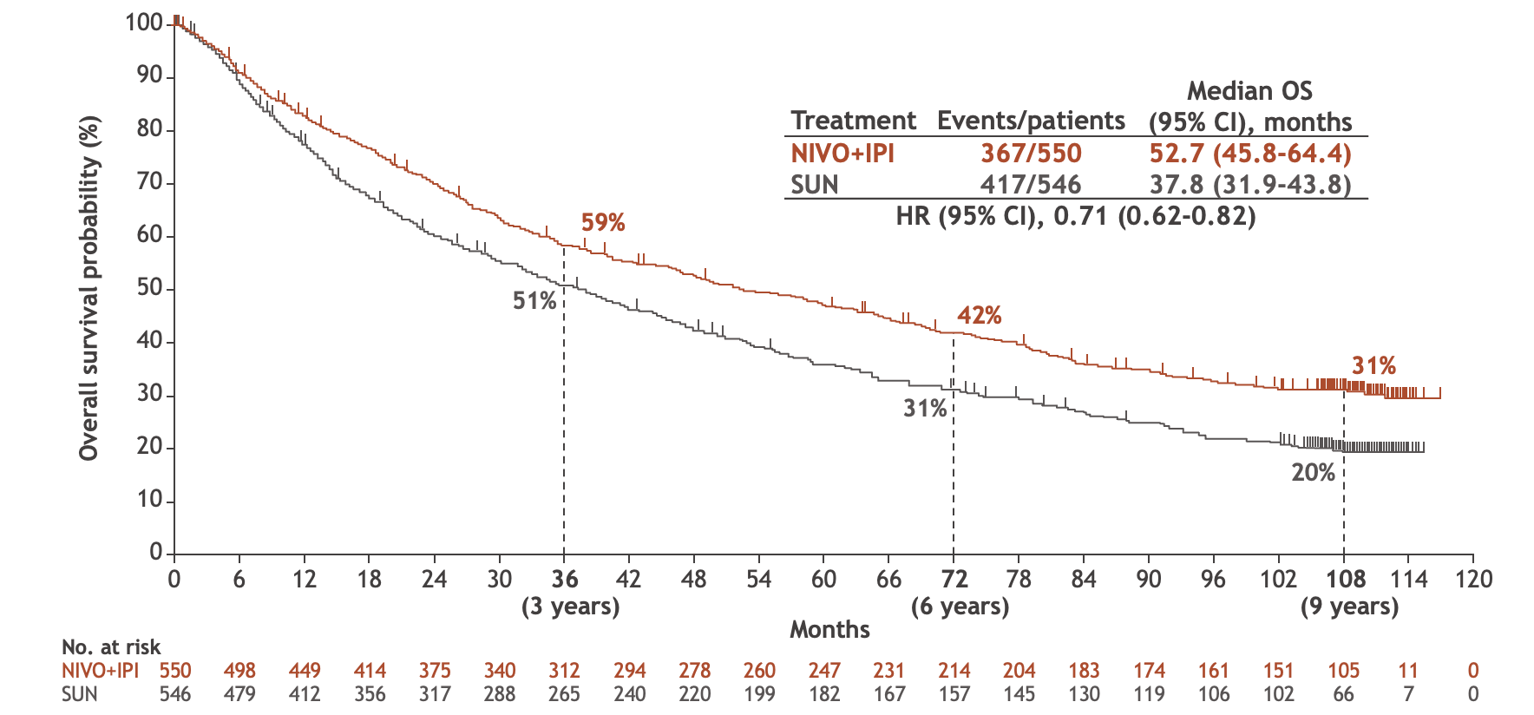
Immune checkpoint inhibitor combinations have made a remarkable difference in ccRCC outcomes
Keynote 426: OS
(5yr follow up)
CLEAR/Keynote 581: OS
(4yr follow up)
Checkmate 9ER OS
(5yr follow up)
Abstract 4505
Checkmate 214 – 9yr follow up OS
9-year survival in a
metastatic population
Choueiri TK et al, ASCO 2025
Rini BI et al, ASCO 2023
Motzer RJ, Porta C, Eto M, et al. J Clin Oncol. 2024.
Motzer RJ et al, NEJM, 2021 ‘
Motzer RJ et al, GU ASCO, 2025
Tian Zhang, MD, MHS

Slide 26
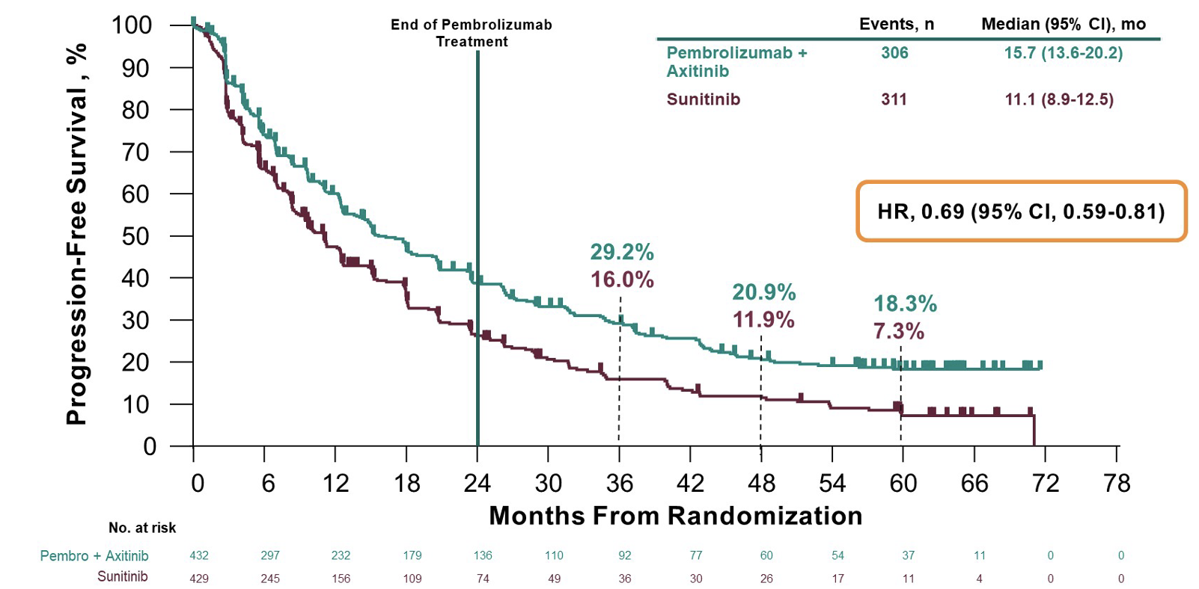
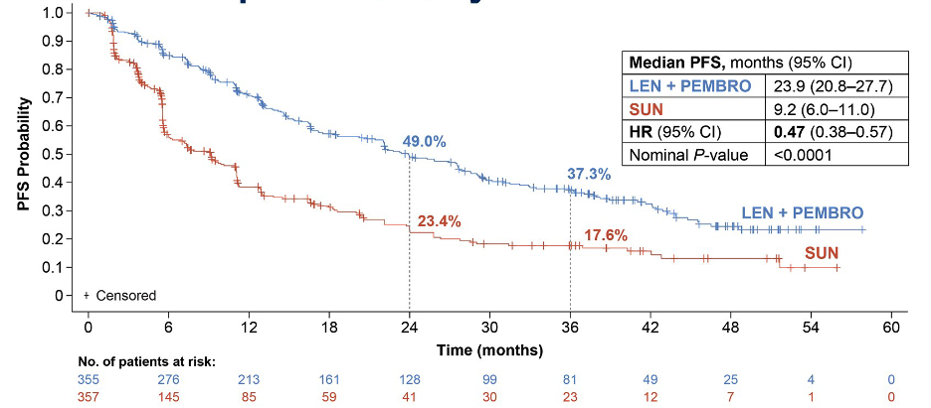
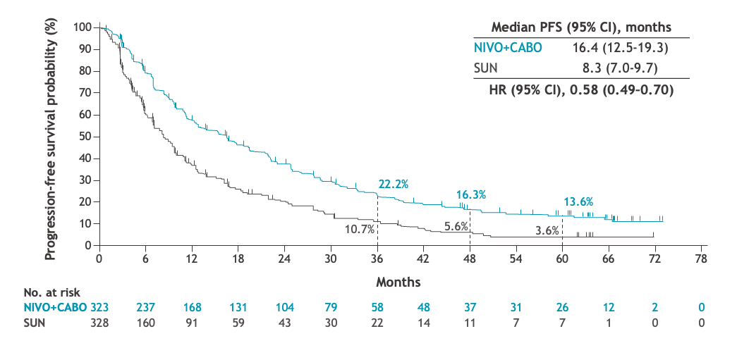
Durability of responses across immunotherapy doublets
Keynote 426: PFS
ITT (5yr follow up)
CLEAR/Keynote 581: PFS
(4yr follow up)
Checkmate 9ER PFS:
67mo follow up
Checkmate 214 – 9yr follow up PFS
Abstract 4505
6-year rates are likely last dependable data
Censored or lost to follow up after 6 years
Choueiri TK et al, ASCO 2025
Rini BI et al, ASCO 2023
Motzer RJ et al, NEJM, 2021 ‘
Motzer RJ et al, GU ASCO, 2025
Tian Zhang, MD, MHS

Slide 27
PDIGREE Design: Phase 3 Adaptive Trial
Step 1
Induction
Step 2 adapted for response
Nivolumab 480mg IV
Every 4 weeks
Discontinue: Progressive disease
Unacceptable toxicity
Complete response at 1 or 2 years
CR
Metastatic renal cell carcinoma
Clear cell component
No prior systemic therapy
HD IL-2 & adjuvant treatment allowed >1 yr prior
IMDC intermediate/poor risk
Ipilimumab 1mg/kg IV
Nivolumab 3mg/kg IV
Every 3 weeks
Non-CR
Non-PD
Nivolumab 480mg IV
Every 4 weeks
3-month
response
(investigator
assessed)
R
Nivolumab 480mg IV
Every 4 weeks +
Cabozantinib 40mg PO daily
N=597
N=1111
PD
Cabozantinib 60mg PO daily
Clinicaltrials.gov
NCT03793166
Primary endpoint: Overall Survival of randomized cohort
Zhang T et al, ASCO 2025
Tian Zhang, MD, MHS

Slide 28
Step 1 Discontinuation Analysis
Registered to Step 1
N=1111
364 patients (33%) withdrew before step 2
160 – AEs
46 – PD
5 before step 1 therapy
42 – patient withdrew
10 before step 1 therapy
39 – alternative therapies
1 before step 1 therapy
37 – deaths
15 from AEs; others due to disease
12 – other complicating disease
20 – other
4 hospice; 2 screen failure before step 1 therapy
8 – physician discretion
Evaluable for toxicity
N=1093
Registration to Step 2 N=747
CR Arm (Nivo alone) N=9
Step 2 randomized cohort
PD Arm (Cabo alone) N=141
Arm A: Nivo N=299
Arm B: Nivo + Cabo N=298
Zhang T et al, ASCO 2025
Tian Zhang, MD, MHS

Slide 29
Step 1 & 2 Patient Characteristics
Patient Characteristics | ITT (Total =1111) | Step 1 Discontinued Subset (N=364) | Step 2 Subset (N=747) | P-value
Age, Median (range) | 64 years (29-86) | 64 years (39-86) | 63 years (29-85) | 0.197
Gender Male (%) Female (%) | 819 (73.7%) 292 (26.3%) | 255 (70.1%) 109 (29.9%) | 564 (75.5%) 183 (24.5%) | 0.053
Ethnicity Hispanic/LatinX Non-Hispanic | 115 (10.4%) 967 (87%) | 27 (7.4%) 330 (90.7%) | 88 (11.8%) 637 (85.3%) | 0.068
Race White Black Asian American Indian or Alaskan native | 945 (85%) 47 (4.2%) 36 (3.2%) 14 (1%) | 313 (86%) 16 (4.4%) 10 (2.7%) 3 (0.8%) | 632 (84.6%) 31 (4.1%) 26 (3.5%) 11 (1.5%) | 0.772
Zhang T et al, ASCO 2025
Tian Zhang, MD, MHS

Slide 30
Step 1 & 2 Disease Characteristics
Disease Characteristics | ITT (Total =1111) | Step 1 Discontinued Subset (N=364) | Step 2 Subset (N=747) | P-value
IMDC risk Intermediate Poor | 849 (76.8%) 257 (23.2%) | 261 (72.3%) 100 (27.7%) | 588 (78.9%) 157 (21.1%) | 0.0144
Bone metastases Yes No | 307 (27.7%) 803 (72.3%) | 124 (34.2%) 239 (65.8%) | 183 (24.5%) 564 (75.5%) | 0.0007
De novo metastases Yes No | 603 (54.3%) 508 (45.7%) | 201 (55.2%) 163 (44.8%) | 402 (53.8%) 345 (46.2%) | 0.66
Enrolling site Academic center Community oncology Regional center | 458 (41.2%) 540 (48.6%) 113 (10.2%) | 143 (39.3%) 177 (48.6%) 44 (12.1%) | 315 (42.2%) 363 (48.6%) 69 (9.2%) | 0.29
Of total in each group, 39% poor risk (vs 30.7% intermediate risk), 40% bone metastases (vs 30% without bone metastases), and 33% de novo metastatic disease (vs 32% without) patient cohorts did not proceed to Step 2
Zhang T et al, ASCO 2025
Tian Zhang, MD, MHS

Slide 31
Step 1 Grade 3 or 4 Treatment-related toxicities
Common Adverse Events (N=1093) | Grade 3 | Grade 4
Diarrhea | 52 (5%) | 1 (0.1%)
AST elevation | 30 (3%) | 4 (0.4%)
ALT elevation | 30 (3%) | 7 (1%)
Colitis | 26 (2%) | 4 (0.4%)
Maculopapular rash | 26 (2%) | 0
Adrenal insufficiency | 19 (2%) | 0
Fatigue | 21 (2%) | 0
Hypophysitis | 16 (1%) | 0
Fifteen grade 5 due to AEs: atrial fibrillation, hepatic failure, sepsis, nutritional disorder, renal disorder other, aspiration, cardiac arrest, respiratory failure x3, death or sudden death NOS x5
Zhang T et al, ASCO 2025
Tian Zhang, MD, MHS
Notes:
RM: Consider white background for the fraph. .

Slide 32
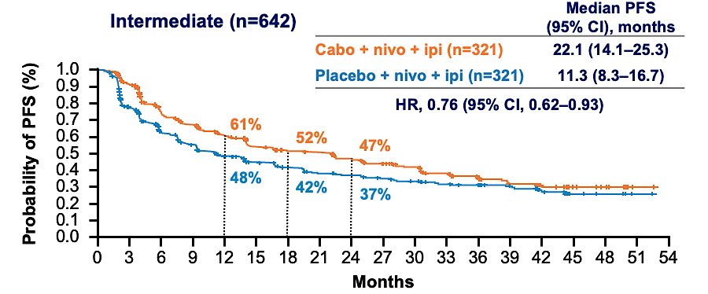
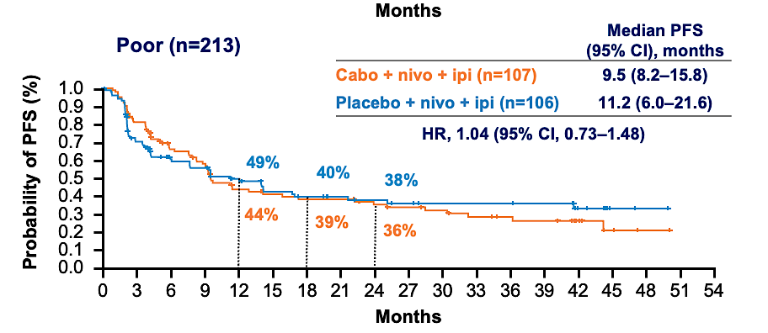
Frontline triplets – COSMIC 313 as a lesson
Abstract 438
No overall survival benefit for cabo-ipi-nivo
Albiges et al, GU ASCO 2025
Tian Zhang, MD, MHS

Slide 33
Triplet therapy had less dose exposure – Treatment exposure matters!
Abstract 438
Treatment exposure and dose modifications
 | Cabo + nivo + ipi (n=426) | Placebo + nivo + ipi (n=423)
Median duration of exposure of study treatment, months (range) | 13.7 (0.2–53.4) | 10.3 (0.1–55.3)
Median average daily dose of cabo/placebo, mg (range) | 22.4 (3.6–40.0) | 35.2 (0.8–40.0)
Median nivo infusions per patient, n (range) | 11.0 (1–52) | 9.0 (1–48)
1 / 2 / 3 / 4 cycles of ipi administered, % | 7 / 22 / 13 / 58 | 6 / 7 / 13 / 74
Dose modification (any treatment component) due to AE, % | 92 | 76
Treatment-related AE leading to discontinuation of ≥1 component, % | 49 | 26
Triplet therapy:
Less average daily dose of cabozantinib
Fewer received 4 cycles of ipilimumab
Almost all patients had dose modification & half discontinued at least 1 study treatment
Albiges et al, GU ASCO 2025
Tian Zhang, MD, MHS

Slide 34
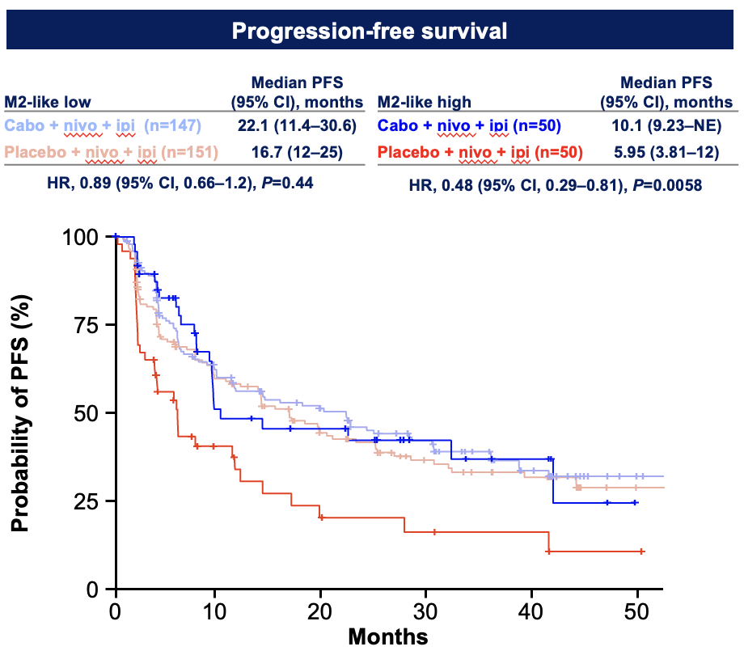
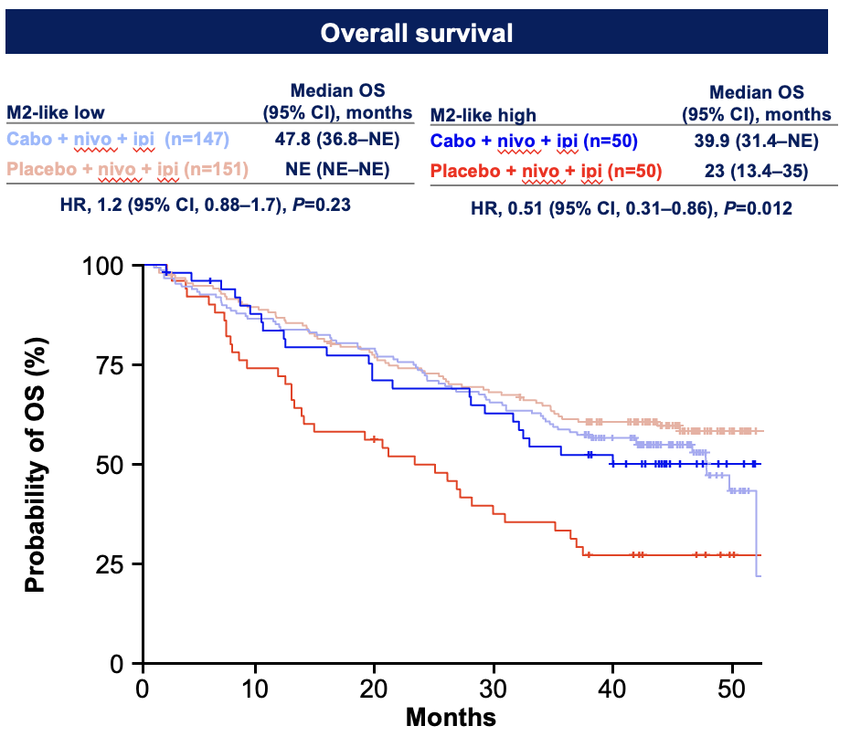
M2-high tumors associated with poor prognosis: Improved outcomes with cabozantinib
Abstract 438
Effect of cabozantinib in M2-high
Effect of cabozantinib in M2-high
A signal for
M2-high tumors – but n=50 does not drive population differences
Albiges et al, GU ASCO 2025
Tian Zhang, MD, MHS
Notes:
VEGF effect

Slide 35
Successful registrational trials in refractory setting
 | AXIS | METEOR | Checkmate-025 | Study 205 | TIVO-3 | LITESPARK 005
Treatment Sample size | Axitinib vs Sorafenib N=723 | Cabozantinib vs Everolimus N=658 | Nivolumab vs Everolimus N=821 | Lenvatinib-everolimus vs Everolimus N=153 | Tivozanib vs Sorafenib N=350 | Belzutifan vs Everolimus N=746
mPFS (months) | 6.7 | 7.4 | 4.6 | 14.6 | 5.6 | 5.6
HR (95% CI) | 0.66 (0.544-0.812) | 0.51 (0.42-0.62) | 0.88 (0.75-1.03) | 0.40 (0.24-0.68) | 0.73 (0.56-0.94) | 0.74* (0.63-0.88)
ORR (%) | 19% | 17% | 25% | 43% | 12.3% | 23%
mOS HR (95% CI) | 0.97 (0.80-1.17) | 0.66 (0.53-0.83) | 0.72 (0.57-0.93) | 0.51 (0.30-0.88) | 0.91 (0.72-1.17) | 0.88* (0.73-1.07)
Rini BI et al, Lancet, 2011
Choueiri TK et al, NEJM, 2015
Motzer RJ et al, NEJM, 2015
Motzer RJ et al, Lancet Onc, 2015
Rini BI et al, Lancet Onc, 2020
Choueiri TK et al, NEJM, 2024
Tian Zhang, MD, MHS

Slide 36
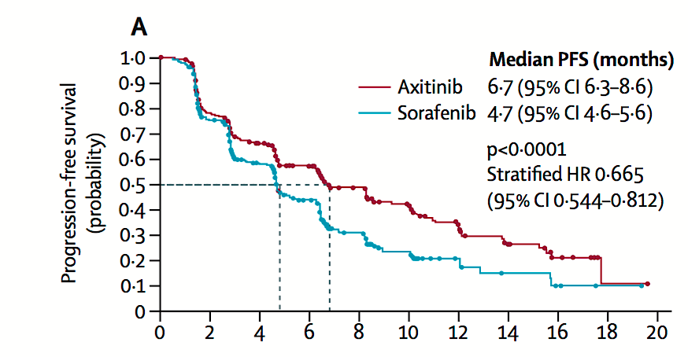
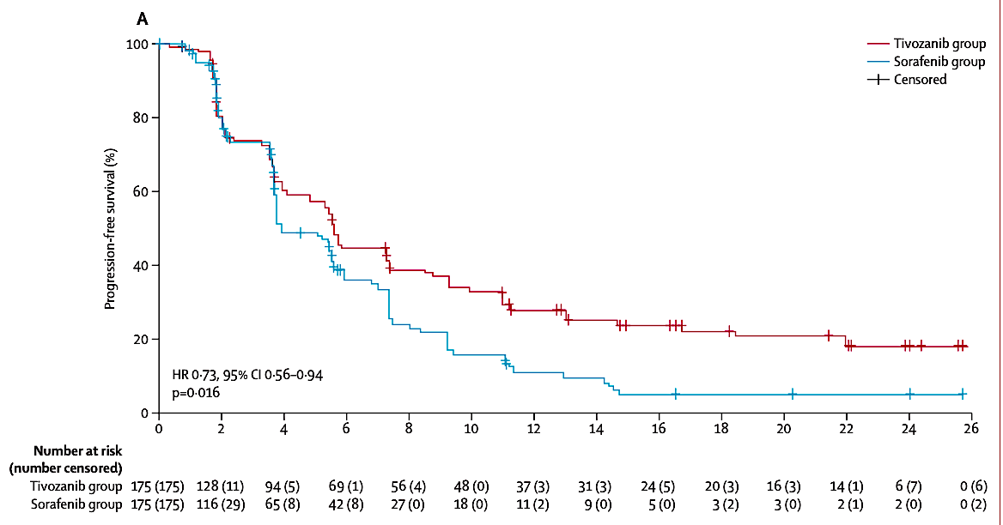
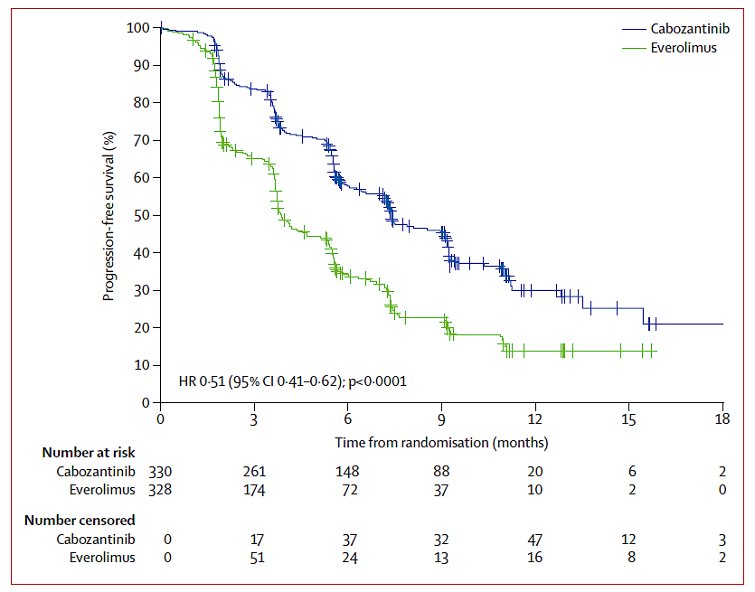
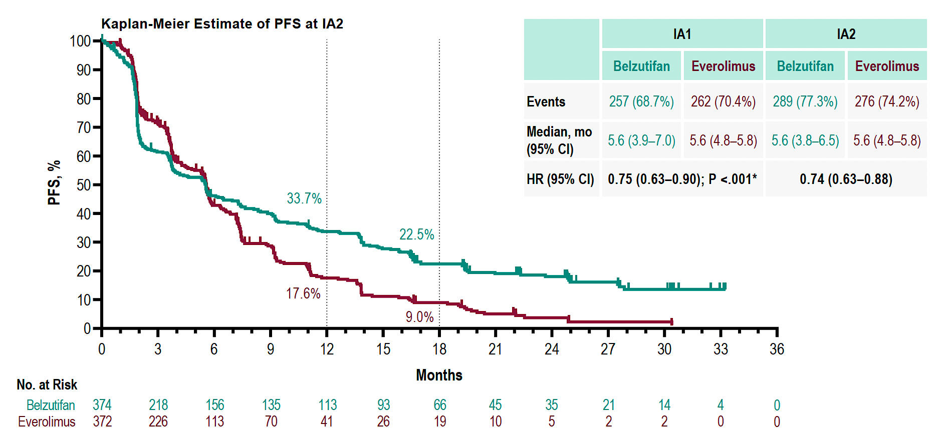
Progression free survival across trials
AXIS - Axitinib vs Sorafenib PFS
TIVO-3 – Tivozanib vs sorafenib PFS
METEOR – cabozantinib vs everolimus
LITESPARK 005 – belzutifan vs everolimus
Rini BI et al, Lancet, 2011
Choueiri TK et al, NEJM, 2015
Motzer RJ et al, NEJM, 2015
Motzer RJ et al, Lancet Onc, 2015
Rini BI et al, Lancet Onc, 2020
Choueiri TK et al, NEJM, 2024
Tian Zhang, MD, MHS

Slide 37
Less successful trials in refractory disease
 | CONTACT-03 | TiNIVO-2 | CANTATA
Treatment Sample size | Cabozantinib-atezolizumab vs cabozantinib N=522 | Tivozanib-nivolumab vs tivozanib N=343 | Cabozantinib + Telaglenastat vs Cabozantinib N=444
mPFS (months) | 10.6 vs. 10.8 | 5.7 vs 7.4 | 9.2 vs 9.3
HR (95% CI) | 1.03 (0.83-1.28) | 1.10 (0.84-1.43) | 0.94 (0.74-1.21)
ORR (%) | 41% vs 40% | 19% vs 20% | 31%
mOS HR (95% CI) | 0.94 (0.70-1.27) | 1.00 (0.68-1.46) | **
Pal SK et al, Lancet, 2023
Choueiri TK et al, ESMO Annual Congress, 2024
Tannir NM et al, r RJ et al, Lancet Onc, 2015
Rini BI et al, Lancet Onc, 2020
Choueiri TK et al, NEJM, 2024
Tian Zhang, MD, MHS

Slide 38
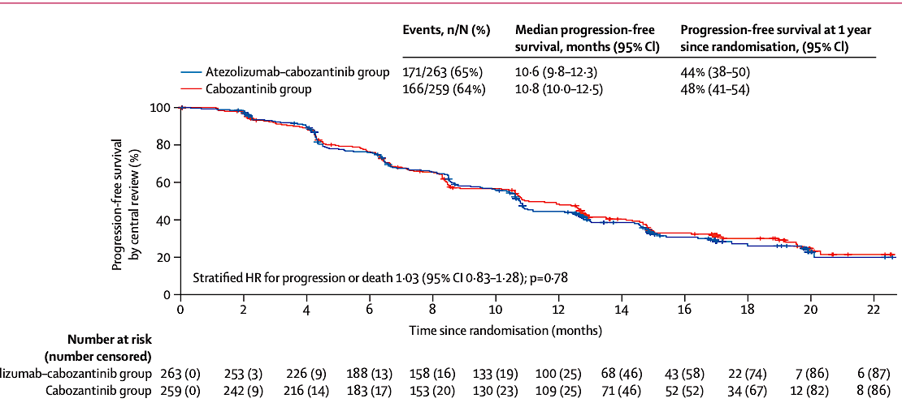
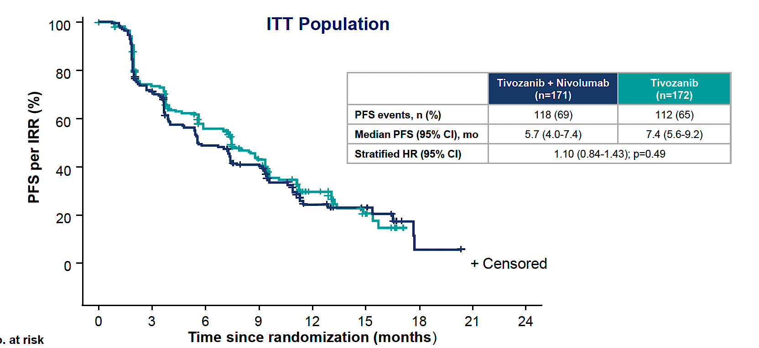
Lessons learned from CONTACT-03 and TiNIVO2
CONTACT-02
TiNIVO-2
Atezolizumab
PD-1 or PDL1 inhibition after prior progression on immunotherapy does not improve PFS outcomes
Tian Zhang, MD, MHS

Slide 39
HIF2a inhibitor trials in refractory RCC
Abstract 438
 | LITESPARK 005 | ARC-20 | ARC-20 | ARC-20 | LITESPARK 003 | Keymaker U03 | ARC-20
Treatment Sample size | Belzutifan vs Everolimus N=746 | Casdatifan 50mg BID N=32 | Casdatifan 50mg daily N=28 | Casdatifan 100mg daily N=27 | Belzutifan 120mg daily + Cabozantinib | Belzutifan 120mg daily + Lenvatinib 20mg daily N=63 | Casdatifan 100mg daily+ Cabozantinib 60mg daily N=24
ORR (%) | 23% | 25% | 29% | 33% | 31% | 46.9% | 45.8%
mPFS (months) | 5.6 | NR | NR | NR | 13.8 | 12.5 | NR
HR (95% CI) | 0.74 (0.63-0.88) | n/a | n/a | n/a | n/a | n/a | n/a
mOS & HR (95% CI) | 0.88 (0.73-1.07) | n/a | n/a | n/a | 26.7 (n/a) | n/a | n/a
Grade 3/4 anemia | 32.5% | 42% | 32% | 17% | 15% | ~20% | 24%
ASCO Abstract 4506
– ARC-20
Choueiri TK et al, NEJM, 2024
Choueiri TK et al, ESMO 2023
Albiges L et al, GU ASCO 2025
Choueiri TK et al, GU ASCO 2025
Choueiri TK et al, ASCO 2025
Tian Zhang, MD, MHS

Slide 40
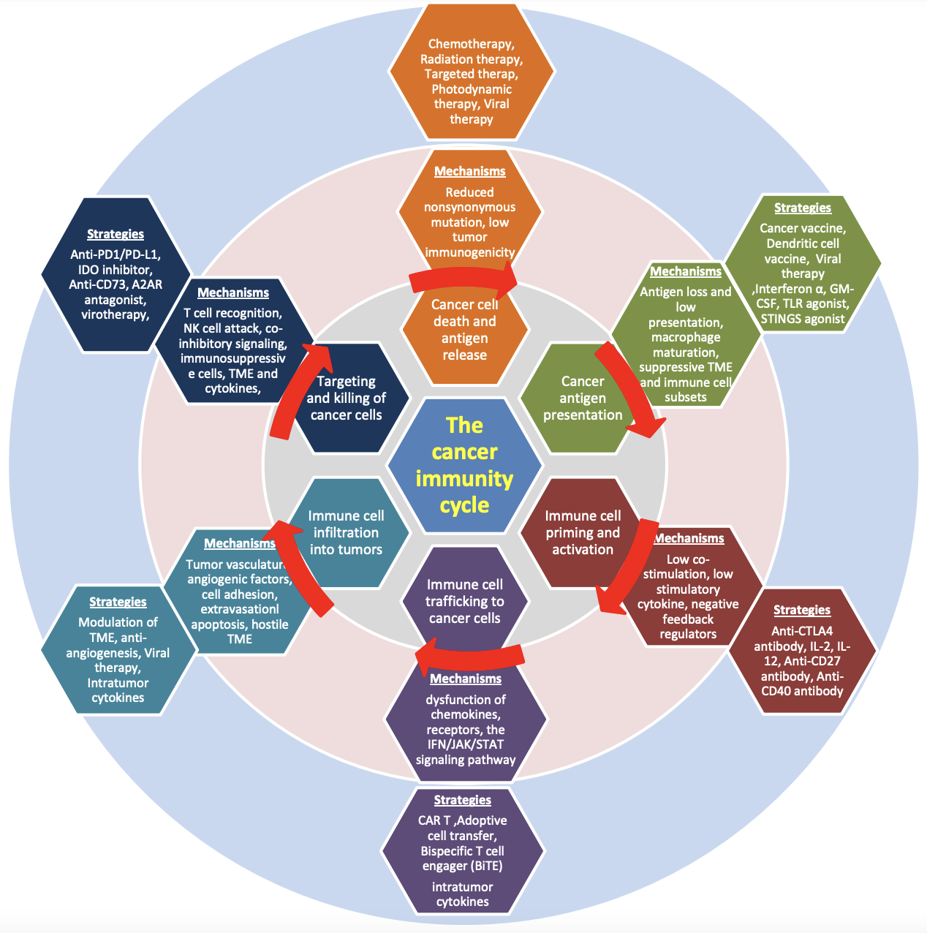
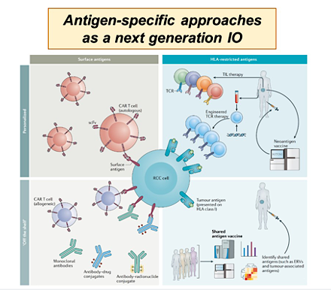
Challenge for future of refractory RCC: Tackle mechanisms of immune checkpoint resistance
therapy,
Interferon
immunosuppresive
CAR T, Adoptive
Zhu S, Zhang T, et al, J Hematol Oncol, 2021; 14: 156
Braun D, Nat Rev Clin Oncol, 2021
Tian Zhang, MD, MHS
Notes:
This is a figure of the tumor immune cycle that we made for an IO resistance review about 2 years ago. In the outermost ring we have thoughts about different treatment strategies that may improve each of the steps of immune-mediated tumor killing.
For purposes of this talk I will discuss two phase 1 studies, one with a Bi-specific T-cell engager and one with a CART cell which were both reported within the past 6 months.

Slide 41
Ultimately our patients win
54yo man
with RCC
1/2020
Lenvatinib/pembrolizumab
9/2008-10/2009
Bevacizumab-RAD-001 trial
5/2017-10/2017:
AGS-16C3F trial:
Randomized to axitinib
78yo man
10/2021-6/2023
Tivozanib
12/2009-9/2011
Sorafenib
2017:
Tibia resection/ BKA for tibia met
9/2019-11/2019
Lenvatinib/everolimus
6/2023-1/2024
Cabozantinib
Nephrectomy
Lung met, s/p
metastasectomy
10/2011-3/2017
BMS-936558 trial (nivolumab)
12/2017-10/2018
bevacizumab
1/2024
Belzutifan
1999
2007
2012
2017
2022
Lived with metastatic RCC for 17 years
10 lines of treatment for metastatic disease
3 interventional trials
3 oncologists: Harshman, Srinivas, Zhang
Sequencing life-extending treatments in RCC
Challenge everyone to continue rational drug discovery
for him and many others like him in our clinics
Tian Zhang, MD, MHS

Slide 42
Outline/Takeaways
Resistance to first-line immunotherapies occurs in many patients
PD-1 therapy has no role for post-IO treated patients
We should change treatment mechanism for patients with IO-refractory disease – tivozanib, belzutifan, and Lenvatinib-everolimus, cabozantinib are all approved
Tian Zhang, MD, MHS

Slide 43
Agenda
Introduction: Adjuvant Immunotherapy for Localized Renal Cell Carcinoma (RCC)
Module 1: Metastatic Clear Cell RCC — Faculty Presentation
Module 2: Metastatic Clear Cell RCC — Survey Questions
Module 3: Non-Clear Cell RCC — Faculty Presentation
Module 4: Non-Clear Cell RCC — Survey Questions
Module 5: ASCO 2025

Slide 44
Approximately how many patients with metastatic clear cell renal cell carcinoma (ccRCC) are currently in your practice?
Median: 6
Have you administered the following for metastatic ccRCC on or off protocol?
Nivolumab/Ipilimumab/cabozantinib: 14 (28%)
Tivozanib alone or in combination nivolumab: 14 (28%)

Slide 45
Questions from General Medical Oncologists — First-Line Treatment for mccRCC
We have 2 main choices for therapy with either combination TKI/IO or dual checkpoint inhibitor therapy. How do we decide which option may be best for an individual patient; and are there any biomarkers that may be useful to help with this decision.
Although I stick to the data and try to provide the most updated and data-driven treatment, I'm always plagued by the confusion of what the single “Best of the Best” is the best. As a general oncologist, renal cancer is a small part of my practice, but it provokes the same therapeutic anxieties as all the other cancers I treat. I guess that's inherent in the field of medical oncology today.

Slide 46
Questions from General Medical Oncologists — First-Line Treatment for mccRCC
An 87-year-old man with metastatic RCC, intermediate-poor risk. Pt started on axi/pembro and did not tolerate axi well. Should a single-agent treatment be considered?
A 76-year-old female with 3 sites of metastases a few years after nephrectomy. Asymptomatic. Good risk. Pt has to take care of ill husband. Poor social support. Should I provide SBRT to all 3 sites vs single-agent TKI or IO vs combination of TKI/IO vs combination of IO/IO?

Slide 47
Questions from General Medical Oncologists — COSMIC-313 Trial
In light of the COSMIC-313 trial results showing improved progression-free survival but no overall survival benefit and increased toxicity with the addition of cabozantinib to nivolumab and ipilimumab, how should clinicians approach the use of this triplet?
How does nivo/ipi/cabo compare to nivo/cabo?
Toxicity related to this combination?

Slide 48
Questions from General Medical Oncologists — Subcutaneous Nivolumab
Are there any insurance issues in getting subcutaneous nivolumab? Any compromise in efficacy?
What is the potential impact of subcutaneous nivolumab on patient adherence and clinic resource utilization compared to the IV formulation?
Nivo just with cabo?

Slide 49
Questions from General Medical Oncologists — Relapsed/Refractory mccRCC
Role of immunotherapy in patients with recurrent disease who have been pretreated in the past with IO in the adjuvant setting.
How do you sequence treatment options in the second-line setting for metastatic ccRCC? Tivozanib vs belzutifan? Does belzutifan have activity in patients without VHL mutation?
Any clinical pearls for managing the side effects of tivozanib, belzutifan and lenvatinib/everolimus?

Slide 50
Questions from General Medical Oncologists — Relapsed/Refractory mccRCC
What evidence or clinical experience supports choosing cabozantinib versus lenvatinib/everolimus in patients progressing on front-line pembrolizumab/axitinib? What is the role of tivozanib in this setting?
Who is the ideal patient for belzutifan? Please comment on management of hypoxia.
I typically choose cabozatinib vs lenvatinib/everolimus based on how symptomatic the patient is. I’d like to see some guidance.

Slide 51
Questions from General Medical Oncologists — Relapsed/Refractory mccRCC
Did TiNivo-2 definitively confirm that ICI rechallenge following progression on ICI therapy should be discouraged in all cases? Does is matter whether the patient progressed on ICI as the most recent line of therapy or after an ICI followed by non-ICI agents?
Would tivozanib be a reasonable option after first-line cabo/nivo? Is it effective in the second line, or would trying another MOA be better?
Which of the various TKIs do you view as most tolerable?

Slide 52
Agenda
Introduction: Adjuvant Immunotherapy for Localized Renal Cell Carcinoma (RCC)
Module 1: Metastatic Clear Cell RCC — Faculty Presentation
Module 2: Metastatic Clear Cell RCC — Survey Questions
Module 3: Non-Clear Cell RCC — Faculty Presentation
Module 4: Non-Clear Cell RCC — Survey Questions
Module 5: ASCO 2025

Slide 53
Non-Clear Cell RCC
Professor Laurence Albiges, MD, PhD
Gustave Roussy Cancer Center
Villejuif, France

Slide 54
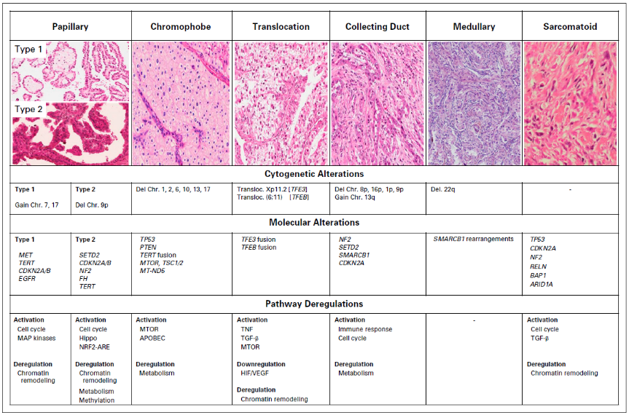
Non-clear cell renal cell carcinoma (nccRCC) subtypes have distinct molecular and genomic features
Adapted from Albiges, et al. J Clin Oncol 2018 Oct 29:JCO2018792531. doi: 10.1200/JCO.2018.79.2531.

Slide 55
SINGLE AGENT TKI

Slide 56
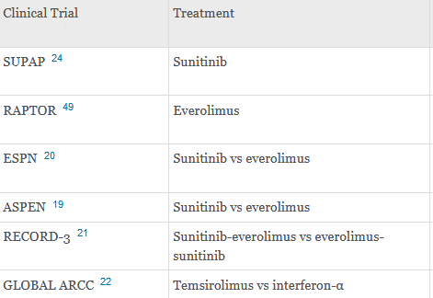
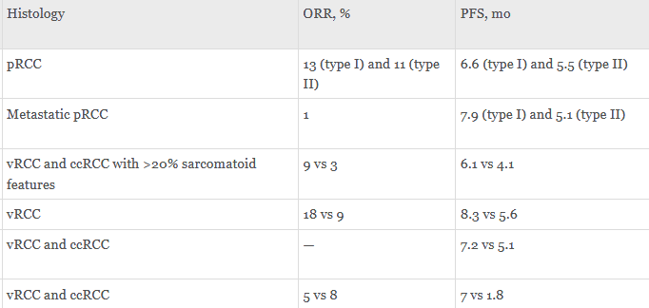
HISTORICAL STUDIES – sunitinib and everolimus
Flippot et al. 2020

Slide 57
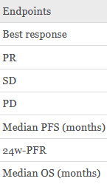
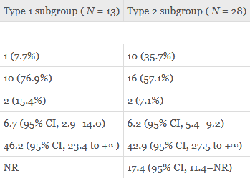
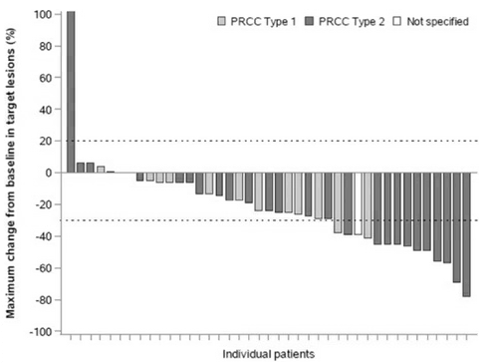
Axitinib Papillary RCC – AXIPAP trial
Négrier et al. EJC 2020

Slide 58
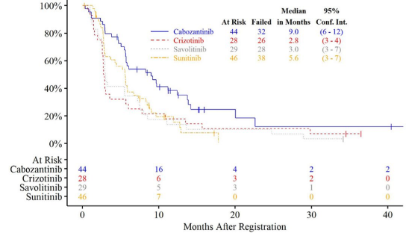
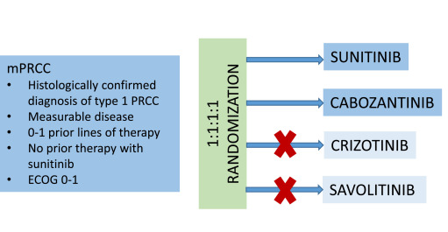
Cabozantinib Papillary RCC – PAPMET trial
PFS
Pal S. Presented at the 2021 Genitourinary Cancers Symposium. By permission of Prof S.K. Pal; Pal S, et al. Lancet 2021;397(10275):695–703.

Slide 59
Comprehensive Molecular Characterisation of Papillary Renal-Cell Carcinoma
The Cancer Genome Atlas Research Network. N Engl J Med 2016;374(2):135-45
Characterisation of clinical cases of advanced papillary renal cell carcinoma via comprehensive genomic profiling
Pal SK, et al. European Urology 2018;73:71-78
MET is a potential target across all papillary renal cell carcinomas: Result from a large molecular study of PRCC with CGH array and matching gene expression array
Albiges L, et al. Clin Cancer Res 2014;20(13):3411-21

Slide 60
MET INHIBITORS: PHASE 2 TRIALS
 | Histology | MET Status | PFS (m) | ORR
Foretinib (N=74) 1st and 2nd line | All papillary | MET +: 10 MET −: 57 NA: 7 | 9.3 | MET +: 50% MET −: 9%
Savolitinib (N=109) 1st–3rd line | All papillary | MET +: 44 MET −: 46 NA: 19 | MET +: 6.2 MET −: 1.4 | MET +: 18% MET −: 0%
Crizotinib (N=109) 1st–3rd line | Type 1 Papillary | MET +: 4 MET −: 16 NA: 3 | 5.8 MET +: 30.5 MET −: 3 | MET +: 50% MET −: 25%
Choueiri TK, et al. J Clin Oncol 2013; Choueiri TK, et al. J Clin Oncol 2017; Schöffski P, et al. ASCO GU 2018.

Slide 61
MET INHIBITORS: SAVOIR

Slide 62
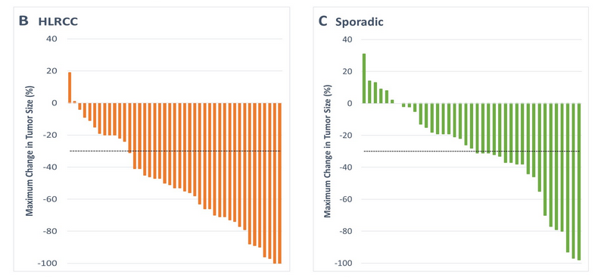
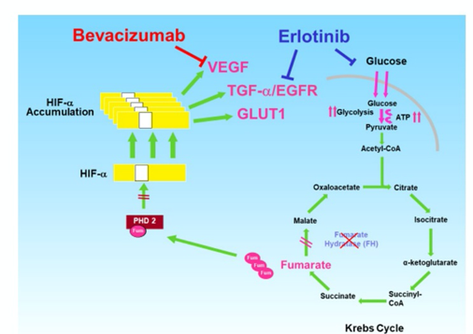
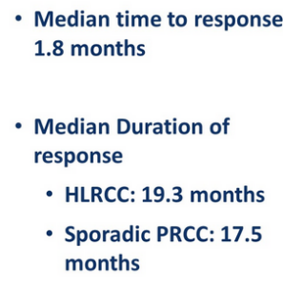
Metabolic alterations and HLRCC
Bevacizumab + erlotinib
Srinivasan ASCO 2020

Slide 63
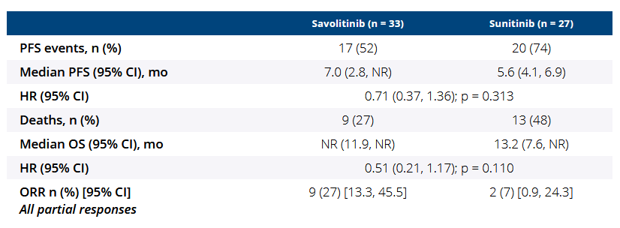
Targeting MET in MET-altered pRcc – the savoir study
MET-driven papillary RCC = MET and/or HGF amplification, chromosome 7 gain and/or MET kinase domain mutations
Choueiri et al. JAMA Oncol 2021

Slide 64
A ROLE FOR IO OR IO-IO

Slide 65
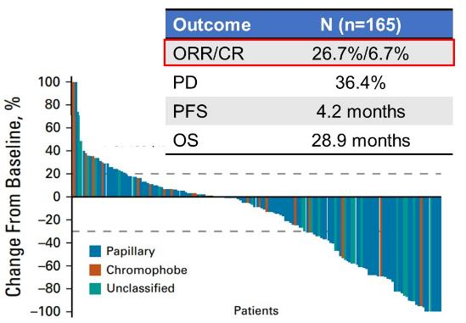
IMMUNOTHERAPY: PEMBROLIZUMAB (KEYNOTE 427)
Open-label, single-arm, Phase 2 study of pembrolizumab monotherapy as first-line therapy in patients with advanced non-clear cell renal cell carcinoma
Cohort A CCRCC
N=110
Response assessed at Week 12, Q6W until Week 54, and Q12W thereafter
Key eligibility criteria
Locally advanced or metastatic disease
Measurable disease per RECIST v1.1 by BICR
No prior systemic therapy for advanced RCC
Karnofsky Performance Status score ≥70%
Screening
for
Eligibility
Pembrolizumab 200 mg Q3W up to 35 cycles (2 years)
Cohort B nccRCC
N=165
Outcome | (n=165)
ORR/CR | 26.7%/6.7%
PD | 36.4%
PFS | 4.2 months
OS | 28.9 months
Endpoints
Primary: ORR (RECIST v1.1 by BICR)
Secondary: OS, PFS, DOR, DCR (RECIST v1.1 by BICR), safety
Characteristics | N (n=165) | ORR
Papillary | 71.5% | 28.8%
Chromophobe | 12.7% | 9.5%
Unclassified | 15.8% | 30.8%
Sarcomatoid | 23.0% | 42.1%
Prior treatment | 0% | 26.7%
PD-L1+ | 61.8% | 35.3% (12.1%)
McDermott D, J Clin Onc 2020:39(9); https://doi.org/10.1200/JCO.20.02365. Lee DL, et al. presented at ESMO 2021

Slide 66
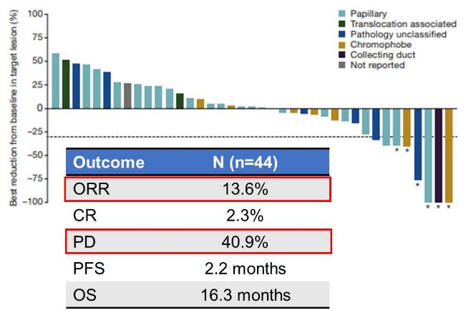
IMMUNOTHERAPY: nivolumab (CHeCKMATE-374)
Safety and efficacy of nivolumab in patients with advanced non-clear cell renal cell carcinoma: Results from the Phase 3b/4 CheckMate 374 Study
Characteristics | N (n=44) | ORR
Papillary | 54.5% | 8.3%
Chromophobe | 15.9% | 28.6%
Unclassified | 18.2% | 12.5%
Translocation | 5% | 0%
Collecting duct | 2% | 100%
Medullary | 2% | 0%
Not reported | 2% | -
Sarcomatoid | 9.1% | 50%
Prior treatment | 34.1% | -
Outcome | (n=44)
ORR | 13.6%
CR | 2.3%
PD | 40.9%
PFS | 2.2 months
OS | 16.3 months
Vogelzang NJ, et al. Clin Genitourin Cancer 2020;18(6):461-468.e3.v DOI: 10.1016/j.clgc.2020.05.006.

Slide 67
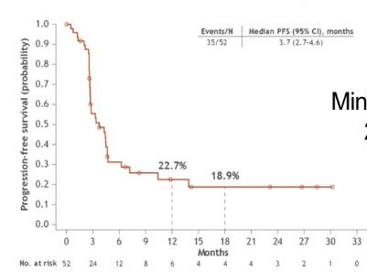
IMMUNOTHERAPY: nivolumab-IPILIMUMAB (CHeCKMATE-920)
Safety and efficacy of nivolumab plus ipilimumab in patients with advanced non-clear cell renal cell carcinoma: results from the phase 3b/4 CheckMate 920 trial
N=200
Key inclusion criteria
Advanced or metastatic RCC (ccRCC and nccRCC)
No prior systemic therapy for advanced/ metastatic RCC
Any IMDC risk
Brain metastases allowed if asymptomatic and not on CS or receiving radiation (enrolled to cohort 3 or 4)
KPS 70% (cohorts 1-3) or 50-60% (cohort 4)
Cohort 1: predominantly ccRCC KPS ≥ 70% (n = 100)
NIVO 6 mg/kg + IPI 1 mg/kg Q8W alternating with NIVO 480 mg Q8W, staggered Q4W
Cohort 2: nccRCC KPS ≥ 70% (n = 50)
NIVO 3 mg/kg + IPI 1 mg/kg Q3W x 4 doses
NIVO
480 mg Q4W
Minimum follow-up 24.1 months
Cohort 3: cc/nccRCC with non-active brain metastases KPS > 70% (n = 25) NIVO 3 mg/kg + IPI 1 mg/kg Q3W x 4 doses
Cohort 4: cc/nccRCC KPS 50% -60% (n = 25) NIVO 3 mg/kg + IPI 1 mg/kg Q3W x 4 doses
Characteristics | N (n=44) | ORR
Unclassified | 42.3% | -
Papillary | 34.6% | -
Chromophobe | 13.5% | -
Translocation | 3.8% | -
Collecting duct | 3.8% | -
Medullary | 1.9% | -
Sarcomatoid | 28.8% | 35.7%
Prior treatment | 0% | 19.6%
PD-L1+ | 38.5% | 30.8%
Treat for ≤ 2 years or until RECIST v1.1-defined progression, unacceptable toxicity, or withdrawal of consent
Outcome
ORR/CR | 19.6%/4.3%
PD | 41.3%
PFS | 3.7 months
OS | 21.2 months
Tykodi SS, et al. J Immunother Cancer 2022;10:e003844. doi:10.1136/jitc-2021-003844.

Slide 68
IMMUNOTHERAPY: NIVOLUMAB-IPILIMUMAB (SUNNIFORECAST)

Slide 69
A ROLE FOR IO-TKI

Slide 70
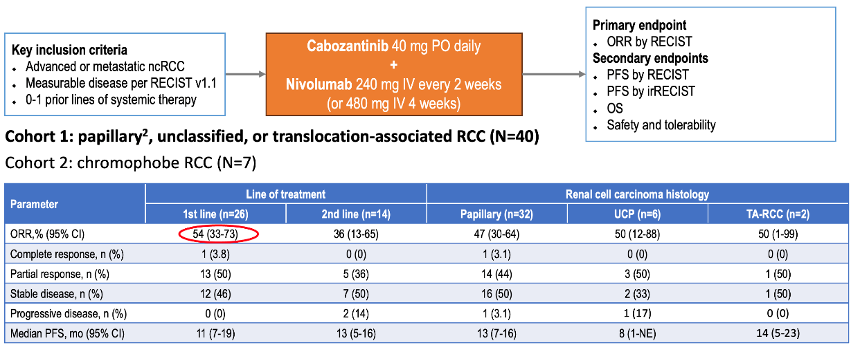
NIVOLUMAB+CABOZANTINIB IN NON-CLEAR RCC
Fitzgerald KN, et al. Eur Urol 2024;86(2):90-94;

Slide 71
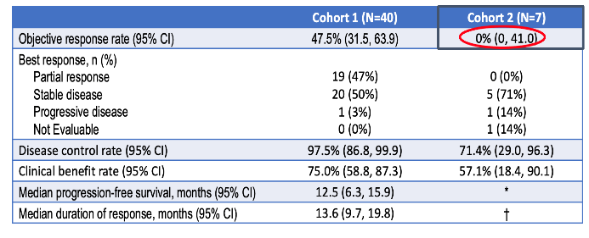
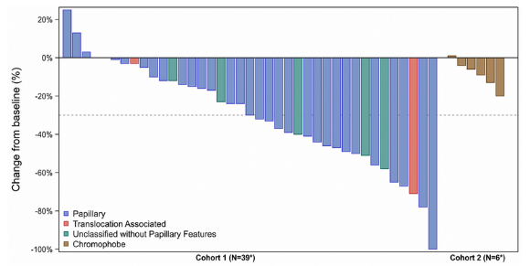
NIVOLUMAB+CABOZANTINIB IN NON-CLEAR RCC
Fitzgerald KN, et al. Eur Urol 2024;86(2):90-94;

Slide 72
LENVATINIB-PEMBROLIZUMAB IN NON-CLEAR RCC
(KEYNOTE-B61)
Albiges L, et al. Lancet Oncol 2023;24(8):881-891; Voss M.ASCO GU Meeting 2024.

Slide 73
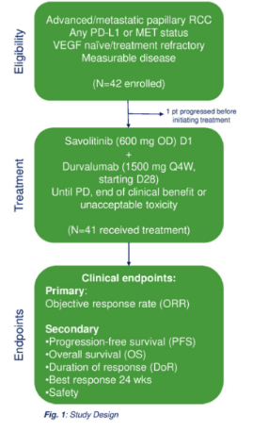
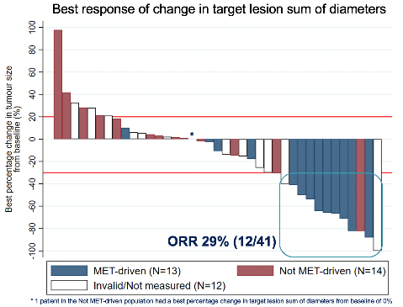
DURVALUMAB+SAVOLITINIB IN PAPILLARY RCC (CALYPSO)
Phase 2 study investigating the safety and efficacy of savolitinib and durvalumab in metastatic papillary renal cancer (CALYPSO)
14/41 (34%) patients in the PRC cohort were MET-driven defined as:
MET amplification
MET kinase domain variations
chromosome 7 gain
HGF amplification
Response in MET-driven papillary RCC patients
Confirmed response rate in MET-driven patients was 57% (8/14)
Median duration of response was 9.4 months
Median follow-up is 26.8 months.
Suárez C, et al. Phase II Study Investigating the Safety and Efficacy of Savolitinib and Durvalumab in Metastatic Papillary Renal Cancer (CALYPSO), J Clin Oncol 41(14), 2493-2502. https://doi.org/10.1200/JCO.22.01414.

Slide 74
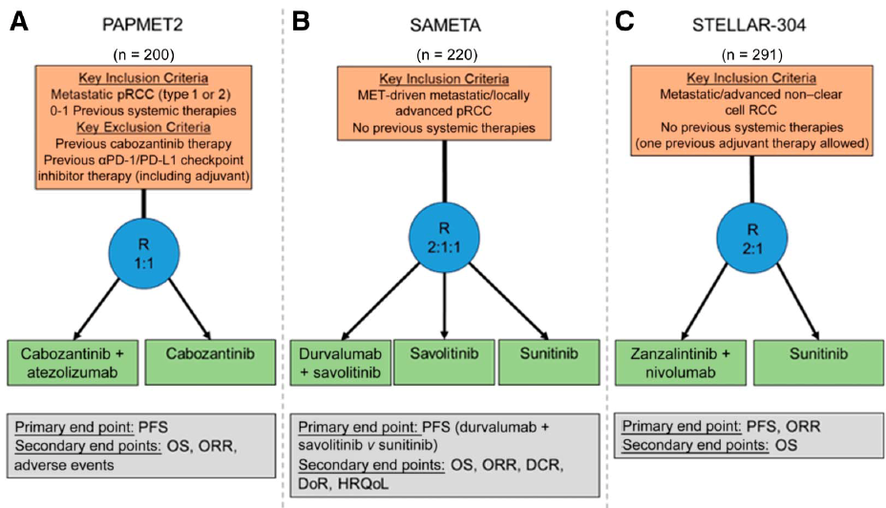
ONGOING TRIALS FOR NON-CLEAR CELL RCC
Am Soc Clin Oncol Educ Book. 2024 Jun;44(3):e438642.

Slide 75
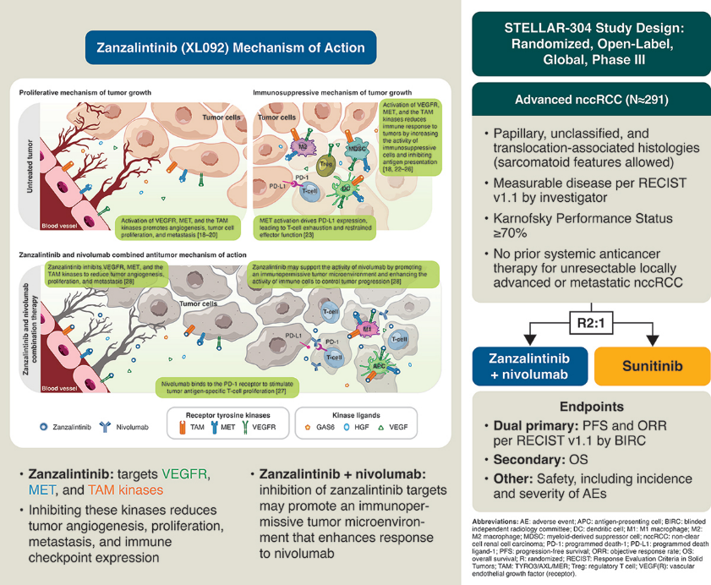

Slide 76
TAKE HOME MESSAGES
Non- clear cell RCC : heterogeneous group, only ~25% of RCC
Low level of evidence for systemic therapy
Clinical trials should be preferred
Rare cancer networks/expert pathology review should be requested
First-line in 2025
IO - TKI
Randomized data are pending !

Slide 77
Agenda
Introduction: Adjuvant Immunotherapy for Localized Renal Cell Carcinoma (RCC)
Module 1: Metastatic Clear Cell RCC — Faculty Presentation
Module 2: Metastatic Clear Cell RCC — Survey Questions
Module 3: Non-Clear Cell RCC — Faculty Presentation
Module 4: Non-Clear Cell RCC — Survey Questions
Module 5: ASCO 2025

Slide 78
Questions from General Medical Oncologists — Metastatic Non-Clear Cell RCC
Is there a way of rating one TKI over another? How does front-line TKI affect choice of second line?
How do you manage diabetic or hypertensive patients with proteinuria when you are trying to give TKI therapy (progressed on immunotherapy, already on ACE inhibitor)?

Slide 79
Questions from General Medical Oncologists — Metastatic Non-Clear Cell RCC
A major barrier I encounter is the lack of clear guidance and trial data for treating non-clear cell histologies, particularly in patients who cannot tolerate immunotherapy. This makes clinical decision-making uncertain and variable across institutions.

Slide 80
Questions from General Medical Oncologists — Zanzalintinib for Non-Clear Cell RCC
I know this is a multitargeted TKI including inhibition of VEGF. Are there patients who are out two or three regimens and may have developed mutations where this drug may be of value? Is repeat NGS sequencing important?
How is this agent different from cabozantinib? Is there any reason to believe it may be effective in patients who have previously received cabo?
How does the tolerability of this agent compare to cabozantinib and other TKIs? What are the most common toxicities with this drug?

Slide 81
Agenda
Introduction: Adjuvant Immunotherapy for Localized Renal Cell Carcinoma (RCC)
Module 1: Metastatic Clear Cell RCC — Faculty Presentation
Module 2: Metastatic Clear Cell RCC — Survey Questions
Module 3: Non-Clear Cell RCC — Faculty Presentation
Module 4: Non-Clear Cell RCC — Survey Questions
Module 5: ASCO 2025

Slide 82
Efficacy of second line (2L) treatment with tivozanib (Tivo) as monotherapy or with nivolumab (Nivo) in patients (pts) with metastatic renal cell carcinoma (mRCC) previously treated with an immune checkpoint inhibitor (ICI) combination of ipilimumab (Ipi)/Nivo or vascular endothelial growth factor receptor-tyrosine kinase inhibitor (VEGFR-TKI)/ICI in the phase 3 TiNivo-2 study.
Chehrazi-Raffle A et al.
ASCO 2025;Abstract 4540.

Slide 83
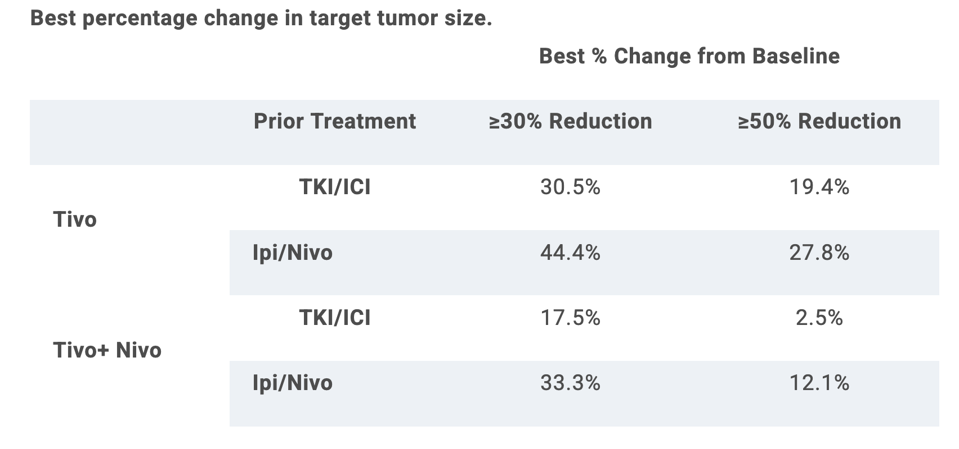
Efficacy of second line treatment with tivozanib +/- nivolumab in patients with mRCC in the phase 3 TiNivo-2 study.
Chehrazi-Raffle A et al. ASCO 2025; Abstract 4540.

Slide 84
Zanzalintinib (zanza) + nivolumab (nivo) ± relatlimab (rela) in patients (pts) with previously untreated clear cell renal cell carcinoma (ccRCC): Results from an expansion cohort of the phase 1b STELLAR-002 study.
Chadoud J et al.
ASCO 2025;Abstract 4515.

Slide 89
Five-year follow-up results from the phase 3 KEYNOTE-564 study of adjuvant pembrolizumab (pembro) for the treatment of clear cell renal cell carcinoma (ccRCC).
Haas NB et al.
ASCO 2025;Abstract 4514.

Slide 90
Ipilimumab and nivolumab in patients with metastatic clear cell renal cell carcinoma (mccRCC) treated on the phase 3 PDIGREE (Alliance A031704) trial: Results from Step 1 analysis.
Zhang T et al.
ASCO 2025;Abstract 4516.

Slide 91
Combination casdatifan plus cabozantinib expansion cohort of phase 1 ARC-20 study in previously treated patients with clear cell renal cell carcinoma.
Choueiri TK et al.
ASCO 2025;Abstract 4506.

Slide 92
ALLO-316 in advanced clear cell renal cell carcinoma (ccRCC): Updated results from the phase 1 TRAVERSE study.
Srour SA et al.
ASCO 2025;Abstract 4508.

Slide 93
Exploratory analysis from NEOAVAX, a neoadjuvant trial of avelumab/axitinib in patients (pts) with localized renal cell carcinoma (RCC) who are at high risk of relapse after nephrectomy. Abstract
Bex A et al.
ASCO 2025;Abstract 4509.

Slide 94
Genomic characterization of baseline and post-progression tumors in IMmotion010, a randomized, phase 3 study of adjuvant (adj) atezolizumab (atezo) vs placebo (pbo) in patients (pts) with high-risk localized renal cell carcinoma (RCC).
Pal SK et al.
ASCO 2025;Abstract 4510.

Slide 95
Nivolumab plus ipilimumab vs sunitinib for first-line treatment of advanced renal cell carcinoma: Final analysis from the phase 3 CheckMate 214 trial.
Motzer RJ et al.
ASCO 2025;Abstract 4505.

Slide 96
An integrative analysis of circulating and tumor microenvironment (TME) determinants of patient response in the Checkmate 9ER (CM 9ER) trial of nivolumab and cabozantinib (NIVO+CABO) in advanced renal cell carcinoma (aRCC).
Braun DA et al.
ASCO 2025;Abstract 4511.

Slide 97
Gut-associated checkpoint as a prognostic biomarker in metastatic renal cell carcinoma (mRCC): Results from a randomized first-line clinical trial.
Saliby RM et al.
ASCO 2025;Abstract 4512.

Slide 98
AREN1721, a randomized phase 2 trial of axitinib+nivolumab combination therapy vs single agent nivolumab for the treatment of TFE/translocation renal cell carcinoma (tRCC) across all age groups, an NCI National Clinical Trials Network (NCTN) phase 2 study.
Geller JI et al.
ASCO 2025;Abstract 4521.

Slide 99
Cases from the Community: Investigators Discuss Available Research Guiding the Care of Patients with Relapsed/Refractory Multiple Myeloma
A CME-Accredited Virtual Event Held in Conjunction with the 2025 ASCO® Annual Meeting
Monday​, June 2, 2025 6:00 PM – 7:00 PM CT (7:00 PM – 8:00 PM ET)
Faculty
Ajay K Nooka, MD, MPH
Paul G Richardson, MD
Moderator
Neil Love, MD

Slide 100
Thank you for joining us! Please take a moment to complete the survey currently up on Zoom. Your feedback is very important to us. The survey will remain open for 5 minutes after the meeting ends. Information on how to obtain CME credit is provided in the Zoom chat room. Attendees will also receive an email in 1 to 3 business days with these instructions.

