Slide 1
Data + Perspectives: Clinical Investigators Discuss the Current and Future Clinical Care of Patients with Prostate Cancer
Saturday, May 31, 2025 7:00 PM – 9:00 PM CT (8:00 PM – 10:00 PM ET)
Faculty
Neeraj Agarwal, MD, FASCO
Andrew J Armstrong, MD, ScM
Himisha Beltran, MD
Fred Saad, MD
Moderator
Rana R McKay, MD

Slide 2
Faculty
Neeraj Agarwal, MD, FASCO
Professor of Medicine
Senior Director for Clinical Research
Huntsman Cancer Institute Presidential Endowed Chair of Cancer Research
Director, Center of Investigational Therapeutics
Director, Genitourinary Oncology Program
Huntsman Cancer Institute, University of Utah (NCI-CCC)
Salt Lake City, Utah
Fred Saad, MD
Professor and Chairman, Department of Surgery
Raymond Garneau Chair in Prostate Cancer
University of Montreal
Director of GU Oncology
University of Montreal Hospital Center (CHUM)
Montréal, Québec, Canada
Andrew J Armstrong, MD, ScM
Professor of Medicine, Surgery, Pharmacology
and Cancer Biology
Director of Research
Duke Cancer Institute Center for Prostate
and Urologic Cancers
Divisions of Medical Oncology and Urology
Duke University
Durham, North Carolina
Moderator Rana R McKay, MD
Professor of Medicine and Urology
Associate Director, Clinical Research
Co-Lead, Genitourinary Program
Moores Cancer Center
University of California San Diego
San Diego, California
Himisha Beltran, MD
Associate Professor of Medicine
Lank Center for Genitourinary Oncology and the Division of Molecular and Cellular Oncology
Director of Translational Research
Medical Oncology
Dana-Farber Cancer Institute
Boston, Massachusetts

Slide 3
Dr Agarwal — Disclosures Faculty
No relevant conflicts of interest to disclose

Slide 4
Dr Armstrong — Disclosures Faculty
Advisory Committees | Astellas, AstraZeneca Pharmaceuticals LP, Bayer HealthCare Pharmaceuticals, Cytogen Corporation, Janssen Biotech Inc, Merck, Myovant Sciences, Novartis, Pfizer Inc
Consulting Agreements | Astellas, AstraZeneca Pharmaceuticals LP, Bayer HealthCare Pharmaceuticals, Curium, Janssen Biotech Inc, Merck, Novartis, Pfizer Inc
Contracted Research | Amgen Inc, Astellas, AstraZeneca Pharmaceuticals LP, Bayer HealthCare Pharmaceuticals, Bristol Myers Squibb, Janssen Biotech Inc, Merck, Novartis, Pathos, Pfizer Inc

Slide 5
Dr Beltran — Disclosures Faculty
Advisory Committees | Amgen Inc, Astellas, Bayer HealthCare Pharmaceuticals, Daiichi Sankyo Inc, Merck, Novartis, Pfizer Inc
Contracted Research | Bristol Myers Squibb, Circle Pharma, Daiichi Sankyo Inc, Novartis
Data and Safety Monitoring Boards/Committees | AstraZeneca Pharmaceuticals LP

Slide 6
Dr Saad — Disclosures Faculty
Advisory Committees and Consulting Agreements | AbbVie Inc, Astellas, AstraZeneca Pharmaceuticals LP, Bayer HealthCare Pharmaceuticals, GSK, Janssen Biotech Inc, Merck, Novartis, Pfizer Inc, Tolmar
Contracted Research | AbbVie Inc, Astellas, AstraZeneca Pharmaceuticals LP, Bayer HealthCare Pharmaceuticals, GSK, Janssen Biotech Inc, Merck, Novartis, Pfizer Inc
Speakers Bureaus | AbbVie Inc, Astellas, AstraZeneca Pharmaceuticals LP, Bayer HealthCare Pharmaceuticals, Janssen Biotech Inc, Merck, Novartis, Pfizer Inc, Tolmar

Slide 7
Dr McKay — Disclosures Moderator
Advisor/Consultant | Ambrx, Arcus Biosciences, AstraZeneca Pharmaceuticals LP, Aveo Pharmaceuticals, Bayer HealthCare Pharmaceuticals, Blue Earth Diagnostics, Bristol Myers Squibb, Calithera Biosciences, Caris Life Sciences, Daiichi Sankyo Inc, Dendreon Pharmaceuticals Inc, Exelixis Inc, Johnson & Johnson Pharmaceuticals, Lilly, Merck, Myovant Sciences, Neomorph, Novartis, Pfizer Inc, Sanofi, Seagen Inc, Sorrento Therapeutics, Telix Pharmaceuticals Limited, Tempus
Institutional Research Funding | Artera, AstraZeneca Pharmaceuticals LP, Bayer HealthCare Pharmaceuticals, Bristol Myers Squibb, Exelixis Inc, Oncternal Therapeutics, Tempus

Slide 8
Dr Love — Disclosures
Dr Love is president and CEO of Research To Practice. Research To Practice receives funds in the form of educational grants to develop CME activities from the following companies: Aadi Bioscience, AbbVie Inc, ADC Therapeutics, Alexion Pharmaceuticals, Amgen Inc, Array BioPharma Inc, a subsidiary of Pfizer Inc, Arvinas, Astellas, AstraZeneca Pharmaceuticals LP, Aveo Pharmaceuticals, Bayer HealthCare Pharmaceuticals, BeiGene Ltd, Black Diamond Therapeutics Inc, Blueprint Medicines, Boehringer Ingelheim Pharmaceuticals Inc, Bristol Myers Squibb, Clovis Oncology, Coherus BioSciences, CTI BioPharma, a Sobi Company, Daiichi Sankyo Inc, Eisai Inc, Elevation Oncology Inc, Exact Sciences Corporation, Exelixis Inc, Genentech, a member of the Roche Group, Genmab US Inc, Geron Corporation, Gilead Sciences Inc, GSK, Hologic Inc, ImmunoGen Inc, Incyte Corporation, Ipsen Biopharmaceuticals Inc, Jazz Pharmaceuticals Inc, Johnson & Johnson, Karyopharm Therapeutics, Kite, A Gilead Company, Kura Oncology, Legend Biotech, Lilly, MEI Pharma Inc, Merck, Mersana Therapeutics Inc, Mirati Therapeutics Inc, Mural Oncology Inc, Natera Inc, Novartis, Novartis Pharmaceuticals Corporation on behalf of Advanced Accelerator Applications, Novocure Inc, Nuvalent, Pfizer Inc, Pharmacyclics LLC, an AbbVie Company, Puma Biotechnology Inc, Regeneron Pharmaceuticals Inc, Rigel Pharmaceuticals Inc, R-Pharm US, Sanofi, Seagen Inc, Servier Pharmaceuticals LLC, SpringWorks Therapeutics Inc, Stemline Therapeutics Inc, Syndax Pharmaceuticals, Taiho Oncology Inc, Takeda Pharmaceuticals USA Inc, TerSera Therapeutics LLC, and Tesaro, A GSK Company.

Slide 9
Commercial Support
This activity is supported by educational grants from Astellas and Pfizer Inc, Bayer HealthCare Pharmaceuticals, and Johnson & Johnson.
Research To Practice CME Planning Committee Members, Staff and Reviewers
Planners, scientific staff and independent reviewers for Research To Practice have no relevant conflicts of interest to disclose.

Slide 10
This educational activity contains discussion of non-FDA-approved uses of agents and regimens. Please refer to official prescribing information for each product for approved indications.

Slide 11
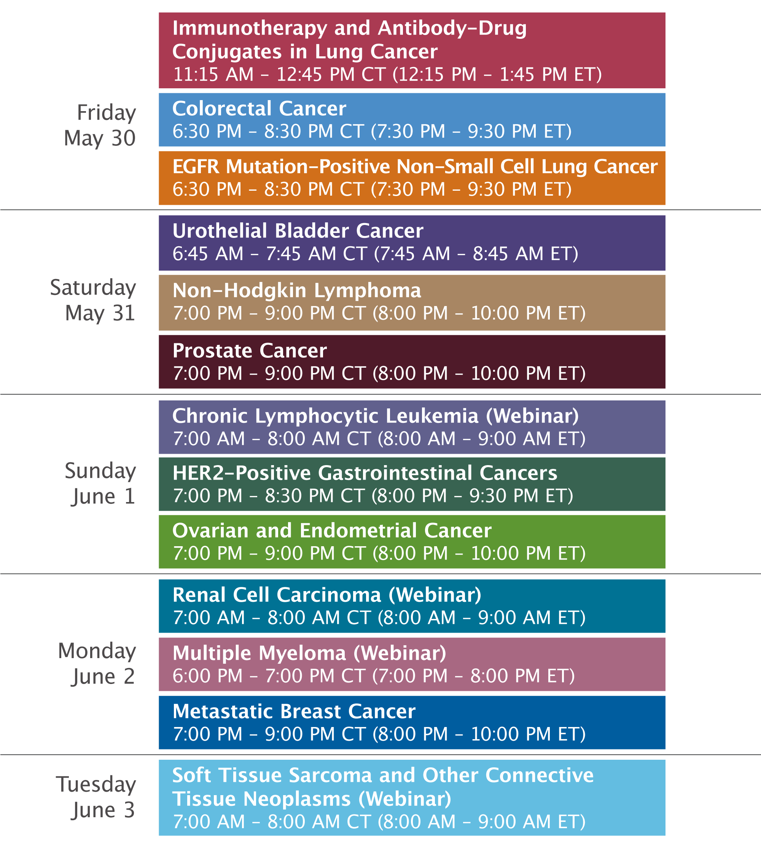

Slide 12
Clinicians in the Meeting Room
Networked iPads are available.
Review Program Slides: Tap the Program Slides button to review speaker presentations and other program content.
Answer Survey Questions: Complete the pre- and postmeeting surveys.
Ask a Question: Tap Ask a Question to submit a challenging case or question for discussion. We will aim to address as many questions as possible during the program.
For assistance, please raise your hand. Devices will be collected at the conclusion of the activity.
Notes:
12

Slide 13
Clinicians Attending via Zoom
Review Program Slides: A link to the program slides will be posted in the chat room at the start of the program.
Answer Survey Questions: Complete the pre- and postmeeting surveys.
Ask a Question: Submit a challenging case or question for discussion using the Zoom chat room.
Get CME Credit: A CME credit link will be provided in the chat room at the conclusion of the program.
Notes:
13

Slide 14
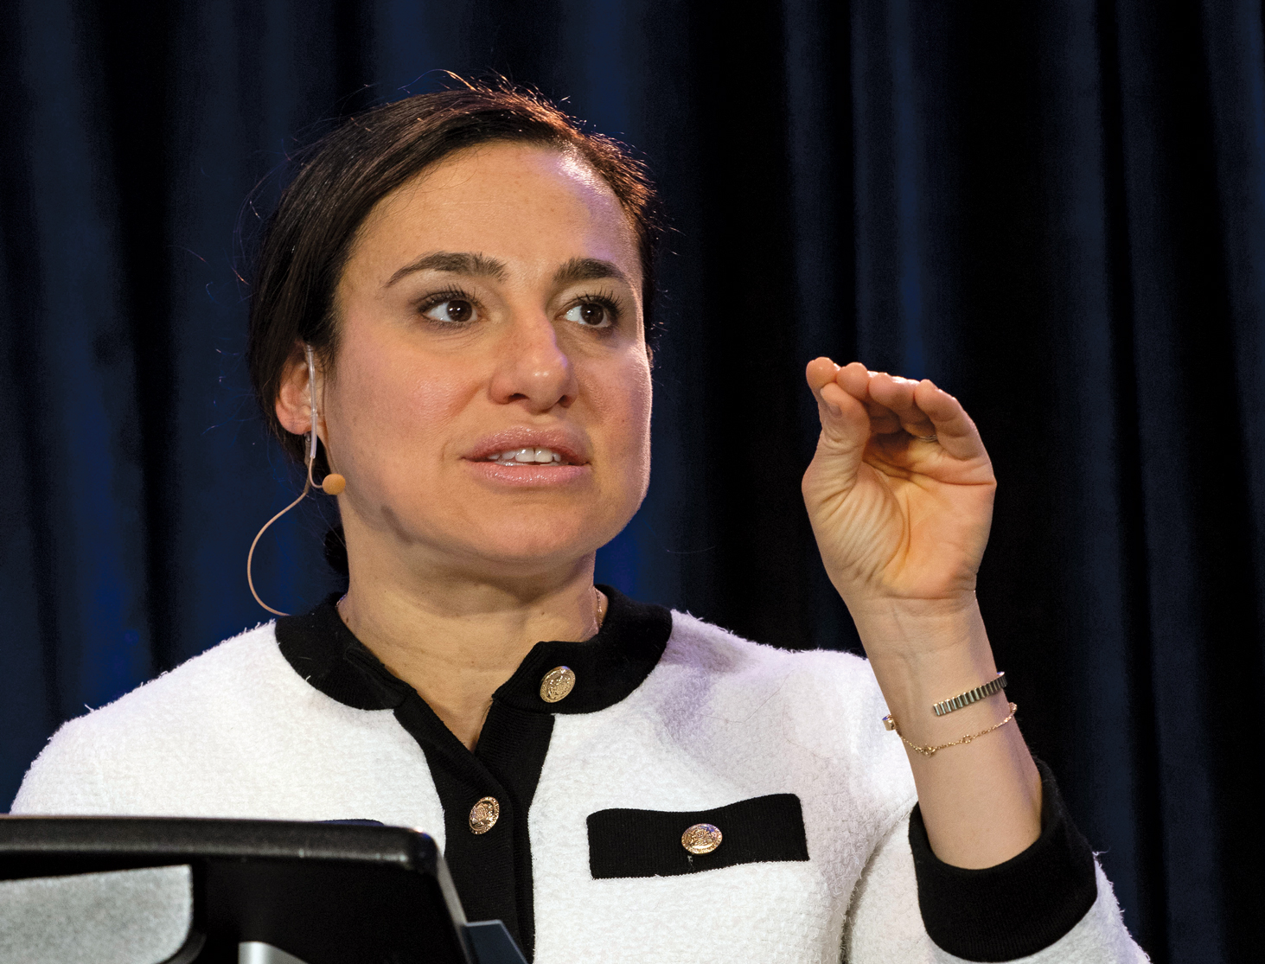
About the Enduring Program
The live meeting is being video and audio recorded.
The proceedings from today will be edited and developed into an enduring web-based program. An email will be sent to all attendees when the activity is available.
To learn more about our education programs, visit our website, www.ResearchToPractice.com
Notes:
14
14

Slide 15
Data + Perspectives: Clinical Investigators Discuss the Current and Future Clinical Care of Patients with Prostate Cancer
Saturday, May 31, 2025 7:00 PM – 9:00 PM CT (8:00 PM – 10:00 PM ET)
Faculty
Neeraj Agarwal, MD, FASCO
Andrew J Armstrong, MD, ScM
Himisha Beltran, MD
Fred Saad, MD
Moderator
Rana R McKay, MD

Slide 16
Agenda
MODULE 1: Evolving Management of Nonmetastatic Hormone-Sensitive Prostate Cancer (HSPC) — Dr Saad
MODULE 2: Current Treatment for Metastatic HSPC — Dr Armstrong
MODULE 3: Role of PARP Inhibition in Metastatic Castration-Resistant Prostate Cancer (mCRPC) — Dr Agarwal
MODULE 4: Current and Future Use of Radiopharmaceuticals for mCRPC — Dr McKay
MODULE 5: Promising Novel Agents and Strategies Under Investigation for the Management of Prostate Cancer — Dr Beltran

Slide 17
Agenda
MODULE 1: Evolving Management of Nonmetastatic Hormone-Sensitive Prostate Cancer (HSPC) — Dr Saad
MODULE 2: Current Treatment for Metastatic HSPC — Dr Armstrong
MODULE 3: Role of PARP Inhibition in Metastatic Castration-Resistant Prostate Cancer (mCRPC) — Dr Agarwal
MODULE 4: Current and Future Use of Radiopharmaceuticals for mCRPC — Dr McKay
MODULE 5: Promising Novel Agents and Strategies Under Investigation for the Management of Prostate Cancer — Dr Beltran

Slide 18
Optimizing care in high risk nmHSPC
Fred Saad CQ MD FRCS FCAHS
Professor and Chairman, Department of Surgery,
Raymond Garneau Chair in Prostate Cancer
University of Montreal
Director of GU Oncology and Prostate Cancer Research
University of Montreal Hospital Center

Slide 19
Spectrum of prostate cancer
Newly diagnosed mHSPC
ADT
Primary progressive mHSPC
ADT
Localised or locally advanced prostate cancer
30%
Biochemical recurrence
ADT
mCRPC
Death
ADT
nmCRPC
Radical prostatectomy
and/or
Radiation therapy
mHSPC, metastatic hormone-sensitive prostate cancer; mCRPC, metastatic castration-resistant prostate cancer; nmCRPC, non-metastatic castration-resistant prostate cancer

Slide 20
Intensifying ADT in high risk prostate cancer

Slide 21
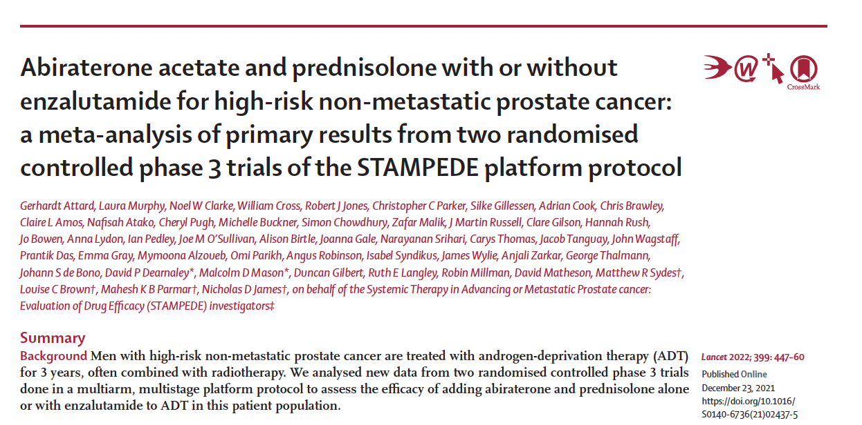
OS

Slide 22
RESULTS
Metastasis-free survival
Overall survival
Gerhardt Attard et al. Lancet 2022

Slide 23
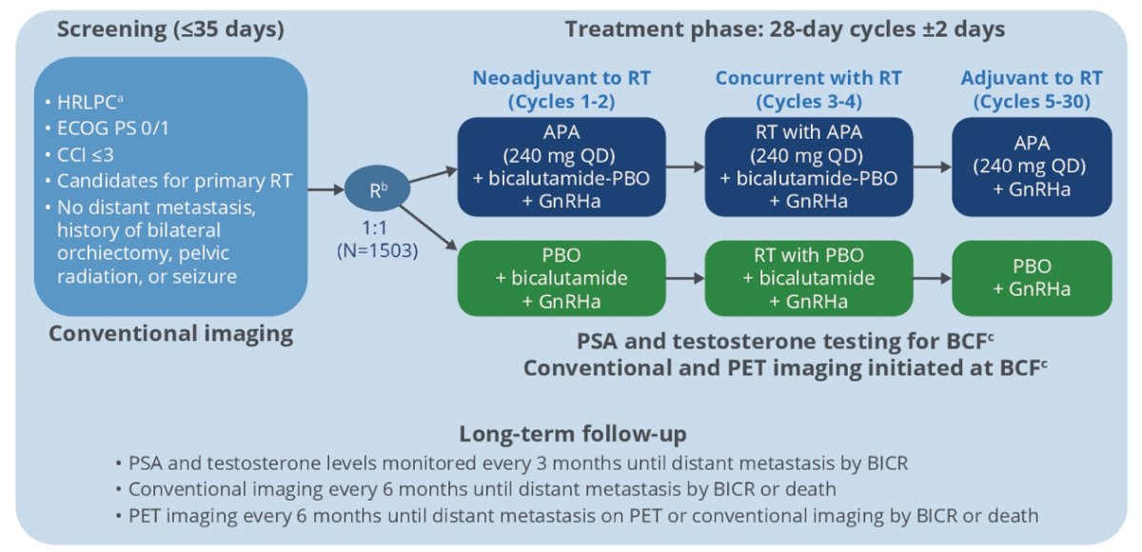
ATLAS
Sandler et al. ASCO 2022;Abstract 5084.

Slide 24
Williams et al. ASCO GU 2018;Abstract TPS156.

Slide 25
DASL HiCaP
Niazi et al. ASCO GU 2023;Abstract TPS396.

Slide 26
PROTEUS: ADT Intensification in Surgery
The primary endpoints are pCR rate and MFS on conventional imaging
MFS based on PSMA PET or conventional imaging will be assessed as a separate endpoint.
Kibel et al. ASCO GU 2022;Abstract TPS285.

Slide 27
Biochemical recurrence
Newly diagnosed mHSPC
ADT
Primary progressive mHSPC
ADT
Localised or locally advanced prostate cancer
Biochemical recurrence
ADT
mCRPC
Terminal progression
ADT
nmCRPC
When to start in the biochemically recurrent non-metastatic patient?
Personal Slide Fred Saad
mHSPC, metastatic hormone-sensitive prostate cancer; mCRPC, metastatic castration-resistant prostate cancer; nmCRPC, non-metastatic castration-resistant prostate cancer

Slide 28
Natural History of Progression
After PSA Elevation Following Radical Prostatectomy
 | Gleason 5-7 |  |  |  | Gleason 8-10
Year of Recurrence | >2 Years |  | ≤2 Years |  | >2 Years |  | ≤2 Years
PSADT | >10 mo | ≤10 mo | >10 mo | ≤10 mo | >10 mo | ≤10 mo | >10 mo | ≤10 mo
3 years (%) | 92 | 66 | 99 | 60 | 84 | 57 | NA | 52
5 years (%) | 92 | 34 | 83 | 24 | 72 | 36 | NA | 27
7 years (%) | 84 | 27 | 75 | 6 | 57 | 24 | NA | 7
Probability of metastases-free progression after biochemical recurrence at 3, 5 and 7 years
1. Partin AW et al.
Notes:
1. Partin AW et al. AUA 2003.

Slide 29
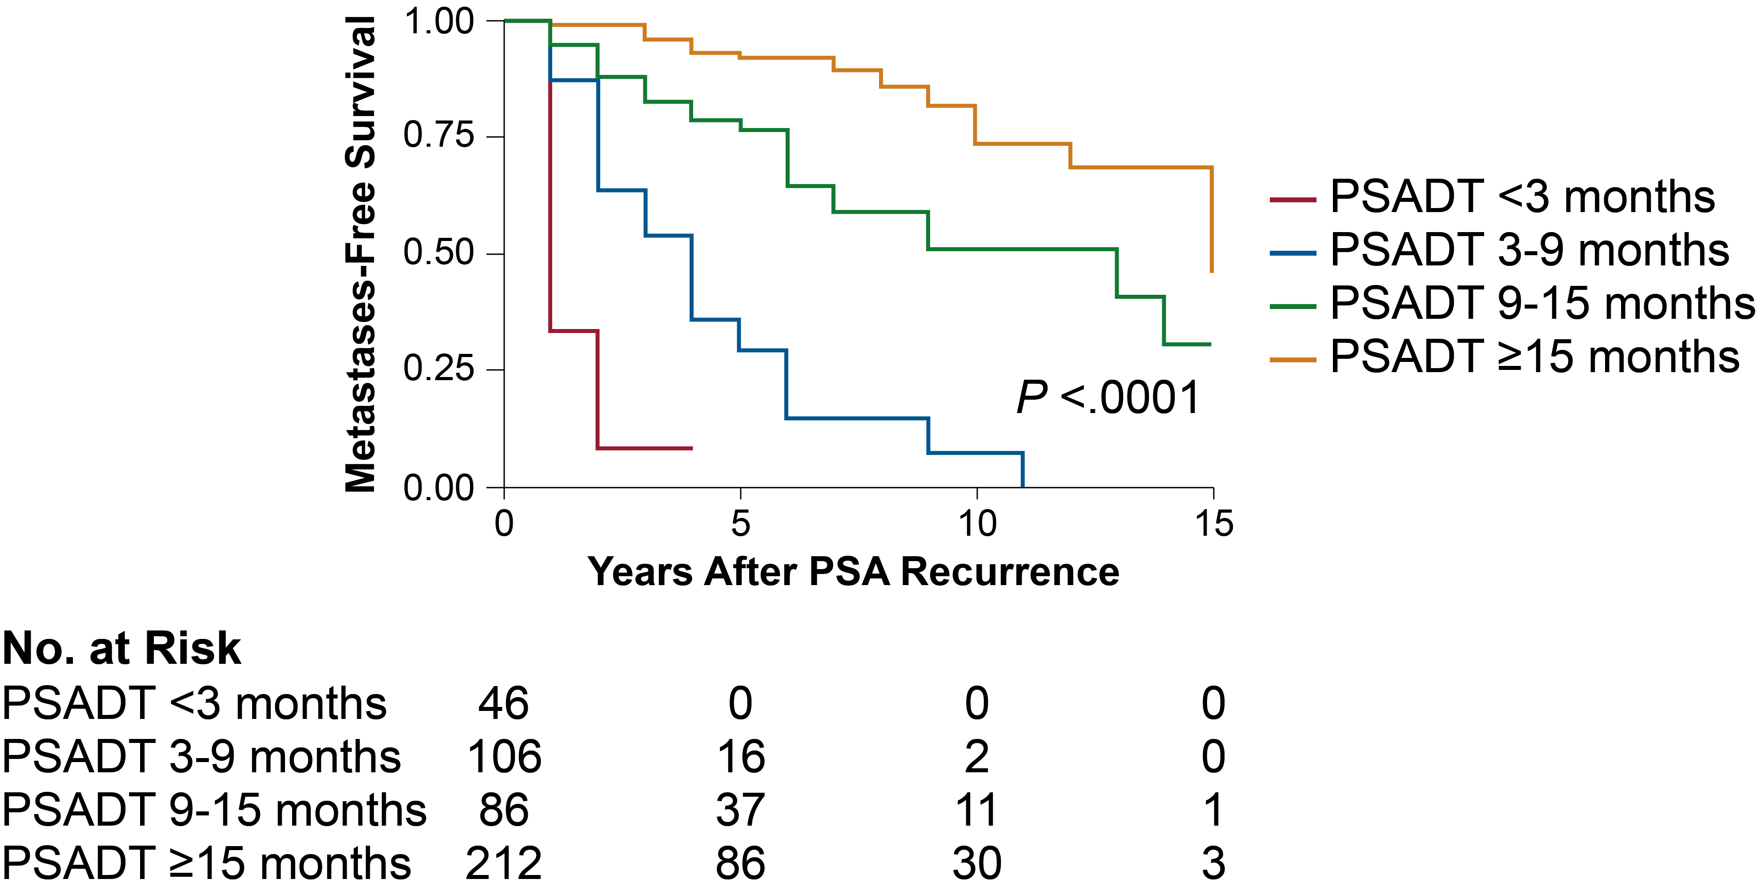
Metastases-Free Survival by PSADT¹
1. Antonarakis et al. BJU Int. 2012;109: 32-39.
Notes:
MFS: metastases-free survival.
1. Antonarakis et al. BJU Int. 2012;109: 32-39.

Slide 30
Systemic treatment options for prostate cancer
Abiraterone
Enzalutamide
Apalutamide
Docetaxel
Docetaxel + darolutamide
Newly diagnosed mHSPC
ADT
Primary progressive mHSPC
ADT
Localised or locally advanced prostate cancer
Biochemical recurrence
ADT
mCRPC
Terminal progression
ADT
nmCRPC
Abiraterone
Enzalutamide
Docetaxel
Cabazitaxel
Radium-223
Olaparib
Lutetium
Can we do better than ADT alone?
Enzalutamide
Apalutamide
Darolutamide
YES

Slide 31
endpoint:

Slide 32
Primary endpoint — MFS for enzalutamide combination vs. leuprolide acetate
Freedland et al. NEJM Oct 2023

Slide 33
Subgroup analysis of MFS for enzalutamide combination vs. leuprolide acetate
Freedland et al. NEJM Oct 2023

Slide 34
Key secondary endpoint — Time to PSA progression for enzalutamide combination vs. leuprolide acetate
Freedland et al. NEJM Oct 2023

Slide 35
Key secondary endpoint — Time to first use of new antineoplastic therapy for enzalutamide combination vs. leuprolide acetate
Freedland et al. NEJM Oct 2023

Slide 36
Key secondary endpoint — Interim OS for enzalutamide combination vs. leuprolide acetate
Freedland et al. NEJM Oct 2023

Slide 37
Safety
Freedland et al. NEJM Oct 2023

Slide 38
Most common TEAEs
Freedland et al. NEJM Oct 2023

Slide 39
Intermittent vs Continuous?
Compromise between early vs delayed

Slide 40
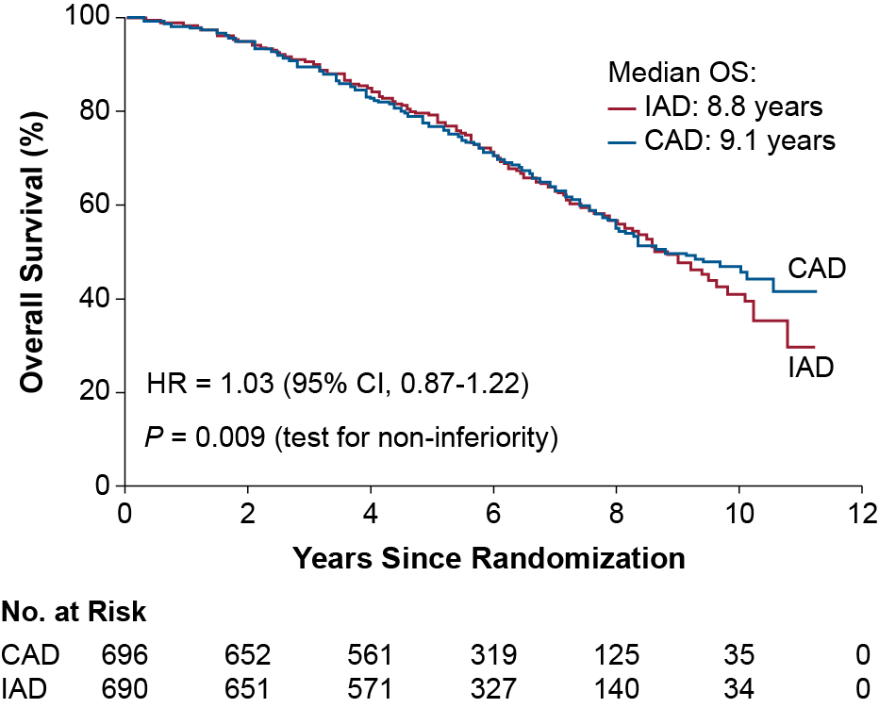
PR.7 (non-metastatic): Overall Survival
Overall Survival, %
Adapted from: Crook JM et al. N Engl J Med. 2012;367:895-903.
Notes:
IAD: intermittent androgen deprivation.
Adapted from: Crook JM et al. N Engl J Med. 2012;367:895-903.

Slide 41
Secondary endpoint Undetectable PSA and Duration of suspension
Freedland et al. NEJM Oct 2023

Slide 42
Can enzalutamide be an effective alternative to ADT?

Slide 43
Key secondary endpoint — MFS for enzalutamide monotherapy vs. leuprolide acetate
Freedland et al. NEJM Oct 2023

Slide 44
Key secondary endpoint — Interim OS of enzalutamide monotherapy vs. leuprolide acetate
Freedland et al. NEJM Oct 2023

Slide 45
Sexual Quality of Life
Freedland et al. Eur Urol 2025

Slide 46
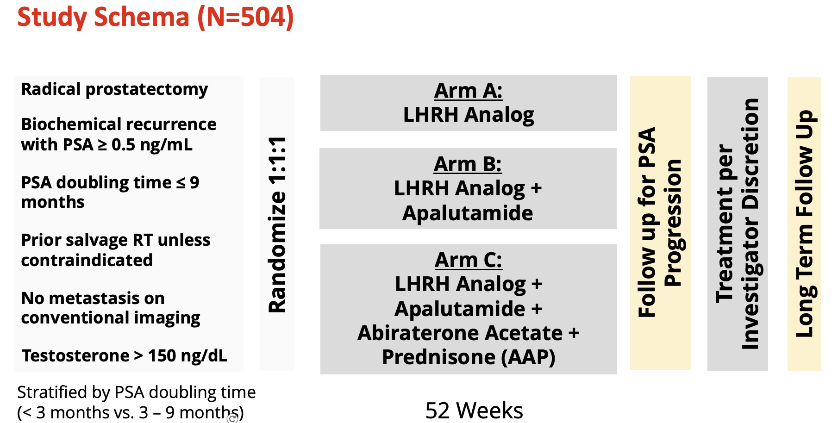

Slide 47
PRESTO (AFT-19): PSA-PFS
Median
PSA-PFS
ADT: 20.3 months
ADT + apa: 24.9 months
ADT: 20.0 months
ADT + apa + AAP: 26.0 months
AAP, abiraterone acetate + prednisone; ADT, androgen deprivation therapy; APA, Apalutamide; LHRH, luteinizing hormone-releasing hormone; PSA, prostate-specific antigen; PSA-PFS, PSA progression free-survival.
Aggarwal R, et al. JCO 42:1114-23, 2024.

Slide 48
Subgroup analysis
 | ADT | ADT + Apa | ADT + Apa + AAP
% Completed Therapy | 87.7% | 93.5% | 91.9%
T recovery to >150 (mo) | 5.1 | 5.7 | 6.9
Serious adverse events* | 8% | 9% | 17%
*Most common: hypertension

Slide 49
DASL HiCaP
Niazi et al. ASCO GU 2023;Abstract TPS396.

Slide 50
ARASTEP

Slide 51
Conclusion
Very high risk localized may benefit from ADT intensification
To reduce their risk of becoming metastatic and dying of prostate cancer
BCR is concerning but not all patients are at the same risk of metastases and death
PSA doubling time allows us to evaluate risk
Lower risk can be followed or consider PSMA directed MDT +/- ADT
Higher risk patients (short PSADT) are in need of better treatment
To reduce their risk of becoming metastatic and dying of prostate cancer
Patients with optimal response may be safely given a treatment holiday thus reducing the cost and morbidity of treatment
Early and optimal hormonally based therapy is effective
in patients with potentially lethal prostate cancer

Slide 52
Faculty Case Presentations

Slide 53
Case Presentation – Dr Armstrong: nmHSPC, enzalutamide monotherapy
56 yo AAM presented with a screening PSA of 8 at age 50, asymptomatic
Biopsy showed GG4 in 12/12 cores, high volume disease
Initial PSMA PET/CT normal other than uptake in prostate, no LAD, SVI
Initially treated with radical prostatectomy, found to have pT3a GG4 bilateral disease, positive margins
PSA persistence with PSA of 0.2 3 months post-op
Completed early salvage RT to the prostate bed only, no ADT 6 mo post-op once urinary incontinence resolved, has return of sexual function despite radiation
Despite radiation, PSA continues to rise. CT/bone scan are normal. PSA rises to 5.0 over a period of 12 months and repeat PSMA PET/CT shows multiple (4) SUV + tiny retroperitoneal and 2 pelvic lymph nodes, SUVs ranging from 6-12, size of 6-8 mm, no bone metastases
PSADT is around 4-5 months
Inquires about approaches to control disease while minimizing impact on quality of life and sexual health.
Married since age 48, no children, works full time and active bicyclist and tennis player

Slide 54
Case Presentation – Dr Armstrong: nmHSPC, enzalutamide monotherapy (cont’d)
Starts enzalutamide monotherapy, no ADT (patient preference to minimize sexual side effects)
PSA drops to undetectable after 6 months and he stops therapy
After 12 months, PSA has risen again quickly to 6.4
He inquires if anything can be done to ensure a longer break from hormonal therapy
Some breast tenderness but this resolved during the treatment break
Reduced libido for about 7-8 months during enzalutamide monotherapy, but this resolved now.

Slide 55
QUESTIONS FOR THE FACULTY
Which patients with biochemical recurrence after definitive local treatment represent ideal candidates for ADT alone versus ADT in combination with enzalutamide versus enzalutamide alone?
How would you compare the global tolerability of enzalutamide monotherapy versus enzalutamide and ADT for patients with nmHSPC? How do they compare in terms of sexual side effects?
Do you have any tricks of the trade for managing the breast symptoms associated with enzalutamide monotherapy?
What would you recommend for this patient given his rising PSA?

Slide 56
Case Presentation – Dr McKay: nmHSPC
Patient Profile:
68-year-old male,
Initial diagnosis: March 2021
PSA at diagnosis: 14.3 ng/mL
Digital rectal exam: Firm, irregular right base
MRI: PI-RADS 5 lesion in right peripheral zone, ECE suspected
Biopsy: Gleason 4+5=9 (Grade Group 5) in 6/12 cores, 80% maximum core involvement
Clinical stage: cT3a N0 M0
Initial treatment:
Radical prostatectomy (May 2021)
Pathology: pT3b (SV+), N0, R1 (positive margin at apex)
Post-op PSA (8 weeks): 0.4 ng/mL
Adjuvant treatment:
External beam radiation (66 Gy to prostate bed + pelvic lymph nodes)
Completed December 2020
PSA nadir after radiation: 0.1 ng/mL (May 2022)
Biochemical recurrence:
PSA rise beginning September 2022
PSA trend: 0.3 ng/mL (Sep 2022) → 0.7 ng/mL (Dec 2022) → 1.4 ng/mL (Feb 2023) → 2.8 ng/mL (May 2023)
PSA doubling time: 4.2 months (high-risk)
Conventional imaging (CT/bone scan): Negative for metastases
PSMA PET/CT: Two small pelvic lymph nodes with mild PSMA uptake (SUVmax 4.2, equivocal)
Current status: Non-metastatic hormone-sensitive prostate cancer (nmHSPC) with biochemical recurrence

Slide 57
Case Presentation – Dr McKay: nmHSPC (cont’d)
Treatment Course:
Started on ADT (leuprolide q3mo) + enzalutamide 160mg daily in July 2023
PSA response:
2.8 ng/mL (pre-treatment)
0.4 ng/mL (1 month)
0.08 ng/mL (2 months)
<0.01 ng/mL (3 months and maintained through present)
Testosterone levels consistently <20 ng/dL
Toxicity:
Grade 2 fatigue, managed with exercise program
Grade 1 hot flashes
Mild cognitive changes
Current status:
10 months into treatment (May 2024)
PSA remains undetectable (<0.01 ng/mL)
Baseline bone density scan showing osteopenia, now on calcium and vitamin D supplements

Slide 58
QUESTIONS FOR THE FACULTY
How do you approach treatment for patients such as this one who experience biochemical recurrence with a rapidly rising PSA after local therapy and have evidence of metastatic disease on PSMA PET but not on conventional imaging?
If this man’s PSA remains undetectable, would you offer him a treatment break? Are you comfortable using intermittent therapy in this population despite their high-risk status? If so, when do you start measuring PSA levels after commencing hormonal therapy, and at what intervals do you do so? At what PSA level do you stop treatment, and when do you reinitiate it?

Slide 59
QUESTIONS FOR THE FACULTY
Outside of a clinical trial, would you currently employ an AR pathway inhibitor other than enzalutamide with or without ADT for patients with biochemically recurrent nmHSPC under any circumstances?

Slide 60
Agenda
MODULE 1: Evolving Management of Nonmetastatic Hormone-Sensitive Prostate Cancer (HSPC) — Dr Saad
MODULE 2: Current Treatment for Metastatic HSPC — Dr Armstrong
MODULE 3: Role of PARP Inhibition in Metastatic Castration-Resistant Prostate Cancer (mCRPC) — Dr Agarwal
MODULE 4: Current and Future Use of Radiopharmaceuticals for mCRPC — Dr McKay
MODULE 5: Promising Novel Agents and Strategies Under Investigation for the Management of Prostate Cancer — Dr Beltran

Slide 61
Current Treatment for Metastatic HSPC (mHSPC)
Andrew J Armstrong MD ScM FACP
ASCO 2025
Professor of Medicine, Surgery, Pharmacology and Cancer Biology
Director of Research
Duke Cancer Institute’s Center for Prostate and Urologic Cancers

Slide 62
Recent Clinical Trials for mHSPC:
TREATMENT INTENSIFICATION IMPROVES SURVIVAL
STAMPEDE
Arm G
(abiraterone)
ENZAMET
(enzalutamide)
Darolutamide/docetaxel/ ADT ARASENS
LATITUDE
(abiraterone)
TITAN
(apalutamide)
Androgen deprivation therapy +/- first generation AR inhibition
(bicalutamide, flutamide)
2014
2015
2017
2018
2019
2020
2021
2022 2024
CHAARTED (docetaxel)
ARCHES
(enzalutamide)
PEACE-1
(abiraterone /radiotherapy /docetaxel)
ARANOTE (darolutamide)
STAMPEDE
Arm C
(docetaxel)
STAMPEDE Arm G (XRT to primary)
2025 ASCO: ARCHES 5 year updates and the AMPLITUDE study (abi +/- niraparib). Come on Tuesday!
Notes:
Here is a nice timeline highlighting the major studies that have been published since 2014 on the treatment of mHSPC
You’ve got docetaxel from CHAARTED and STAMPEDE
Abiraterone from LATITUDE and STAMPEDE
Radiation to the primary from STAMPEDE
Enzalutamide from ENZAMET and ARCHES
Apalutamide from TITAN
And most recently, abi plus doce plus radiation from PEACE-1
What you will notice is that our use of potent androgen receptor therapy has been moved earlier in the treatment course from the mCRPC to the mCSPC setting and has thus changed our treatment approach

Slide 63
mHSPC Therapies with Proven Survival Benefit
Therapy | Prior Docetaxel | Comparator | FFS/PFS benefit, HR, p-value | OS benefit, HR; p-value
Radiation to the Primary | No | No radiation, ADT alone +/- docetaxel | Yes: low volume HR 0.59 p<0.0001 | Yes: low volume HR 0.68 p=0.007
Enzalutamide ARCHES ENZAMET | 18% 44-45% | Placebo/ADT ADT/Bicalutamide | Yes HR 0.39 p<0.0001 Yes HR 0.39 p<0.0001 | Yes HR 0.66 p<0.0001 all volumes Yes HR 0.67 p=0.002 all volumes
Docetaxel/prednisone: STAMPEDE Docetaxel: CHAARTED Docetaxel/Abiraterone | No No Yes | ADT ADT Docetaxel/ADT | Yes HR 0.61 p<0.0001 Yes HR 0.61 p<0.0001 Yes HR 0.47-0.58 p=0.006, <0.0001 | Yes HR 0.76 p=0.005 all volumes Yes HR 0.63 p<0.001 high volume HR 1.04 low volume Yes HR 0.72 p=0.019 high volume de novo
Apalutamide | 11% | Placebo/ADT | Yes HR 0.48 p<0.001 | Yes HR 0.67 p=0.0053 all volumes
Abiraterone/Prednisone LATITUDE Abiraterone/Prednisone STAMPEDE | No | Prednisone | Yes HR 0.47 p<0.0001 | Yes HR 0.66 p<0.001 high risk
 | No | Prednisone | Yes HR 0.31 p<0.0001 | Yes HR 0.61 p<0.001 all risk/volumes
Abiraterone/prednisone (PEACE-1) | 100% (concurrent) | ADT/Docetaxel | Yes HR 0.50 p<0.0001 | Yes HR 0.75 p=0.017; HV: HR 0.72 p=0.019
Darolutamide | 100% (concurrent) | Placebo/ADT/ Docetaxel | Yes CRPC HR 0.35 p<0.0001 | Yes HR 0.675 p<0.0001 de novo 86%
Parker et al Lancet 2018; Armstrong et al JCO 2019 and ESMO/JCO 2021; Davis et al NEJM 2019; James N et al Lancet 2015; Sweeney et al NEJM 2015; Chi KN et al NEJM 2019; Fizazi K et al NEJM 2017; James et al NEJM 2017; Smith MR et al NEJM 2022; Fizazi K et al Lancet 2022

Slide 64
mHSPC Algorithm 2025
Metastatic Hormone-Sensitive Prostate Cancer (mHSPC)
High-volume mHSPC
(based on conventional imaging)
Low-volume mHSPC
(based on conventional imaging)
Synchronous/de novo metastases
Metachronous/relapsed metastases
Synchronous/de novo metastases
Metachronous/ relapsed metastases
Triplet therapy:
Docetaxel + abiraterone + ADT
Docetaxel + darolutamide + ADT
(preferred)
or
Docetaxel + ADT → ADT/enzalutamide
Docetaxel + ADT → ADT/apalutamide
Triplet therapy: Docetaxel + ARSI + ADT vs.
Doublet therapy:
ADT + ARSI or docetaxel
Triplet therapy: Docetaxel + ARSI + ADT vs.
Doublet therapy:
ADT + ARSI or docetaxel
+
Radiation to the primary (+/- pelvis)
Doublet therapy: ARSI + ADT
McManus and Armstrong, JCO 2023

Slide 65
ARASENS by Volume
High-volume disease
Low-volume disease
Hussain et al JCO 2023

Slide 66
Triplet Therapy: High Volume De Novo mHSPC
ADT/docetaxel + abiraterone
ADT/docetaxel
Fizazi K et al Lancet 2023

Slide 67
ARANOTE Study Design
Global, randomized, double-blind, placebo-controlled, phase 3 study
Endpoints
Primary
rPFS by central blinded review
Secondary
OS
Time to initiation of subsequent anticancer therapy
Time to mCRPC
Time to PSA progression
Rates of undetectable PSA (<0.2 ng/mL)
Time to pain progression (BPI-SF)
Safety
Patients (N=669)
mHSPC*
ECOG PS 0–2
Stratification factors
Visceral metastases (Y/N)
Prior local therapy (Y/N)
Darolutamide
600 mg BID + ADT
(N=446)
2:1 randomization
Placebo + ADT
(N=223)
Data cut-off: June 7, 2024
ClinicalTrials.gov: NCT04736199
*Metastatic disease confirmed by conventional imaging method as a positive ^{99m}Tc-phosphonate bone scan or
soft tissue/visceral metastases on contrast-enhanced abdominal/pelvic/chest CT or MRI scan, assessed by central review.
BPI-SF, Brief Pain Inventory-Short Form.
Saad F et al. ESMO 2024; Abstract LBA68

Slide 68
ARANOTE Primary Endpoint: rPFS*
Darolutamide significantly reduced the risk of radiological progression or death by 46%
mHSPC
1.0
0.9
70.3%
0.8
Darolutamide + ADT
Median NR (95% CI NR–NR)
0.7
0.6
rPFS probability
0.5
0.4
52.1%
Placebo + ADT
Median 25.0 mo (95% CI 19.0–NR)
0.3
0.2
HR for rPFS 0.54
(95% CI 0.41–0.71)†
P<0.0001
0.1
0.0
0
3
6
9
12
15
18
21
24
27
30
33
36
39
Patients at risk, n
Time, months
Darolutamide
446
422
388
358
330
309
285
262
186
113
54
9
1
0
Placebo
223
197
178
158
137
109
96
83
58
32
12
2
0
0
Median follow-up: darolutamide group 25.3 months; placebo group 25.0 months
*Primary analysis occurred after 222 events (darolutamide 128; placebo 94).
†HR and 95% CI were calculated using the Cox model stratified on visceral metastases (Y/N) and prior therapy (Y/N).

Slide 69
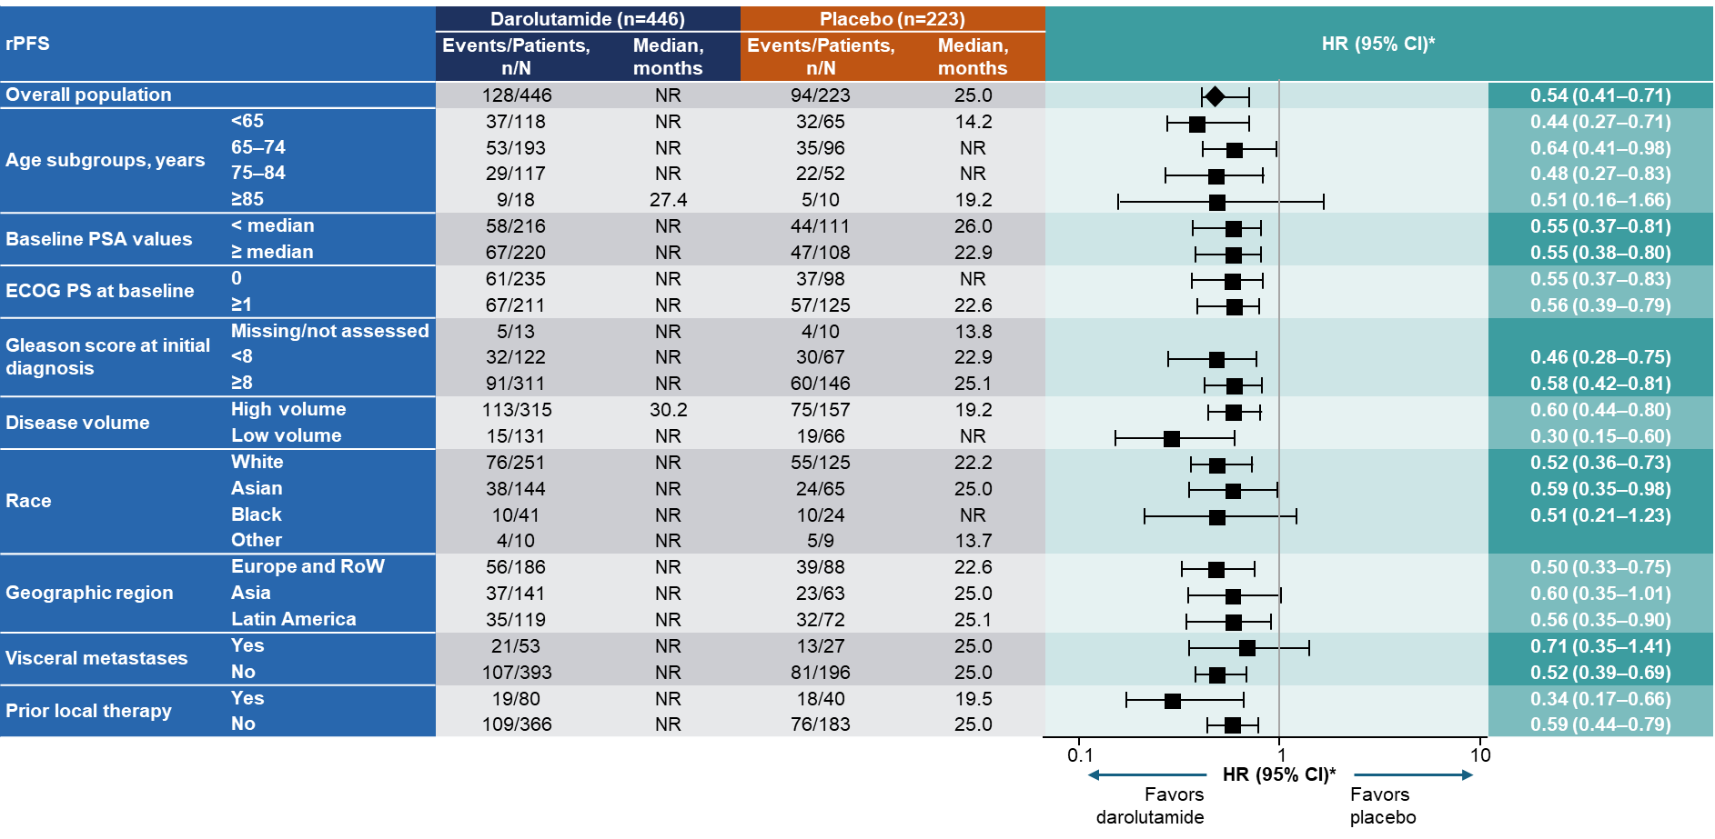
ARANOTE rPFS: Subgroup Analyses
Consistent benefit of darolutamide across all subgroups
Saad F et al. JCO 2024
*HR and 95% CI were calculated from univariate analysis using unstratified Cox regression.

Slide 70
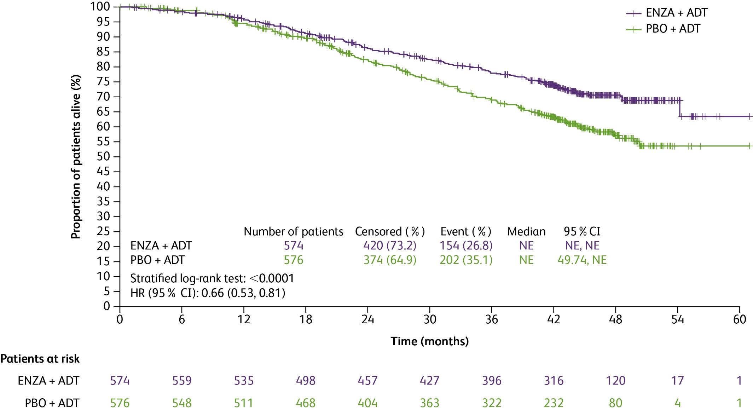
Overall survival with Enzalutamide (ARCHES): updated Tuesday!
86% alive
78% alive
71% alive
82% alive
As of May 28, 2021: 356 deaths (enzalutamide plus ADT, 154; placebo plus ADT, 202) were observed
Median follow-up time: 44.6 mo
Median treatment duration:
Enzalutamide plus ADT: 40.2 mo
Placebo plus ADT: 13.8 mo
Placebo plus ADT crossover: 23.9 mo
69% alive
57% alive
66 vs 53%
Armstrong AJ et al JCO 2022 and ASCO 2025
ADT=androgen deprivation therapy; CI=confidence interval; ENZA=enzalutamide; HR=hazard ratio; ITT=intent-to-treat; NE=not evaluable; PBO=placebo.
Slides are property of the author. Permission required for reuse.
Enzalutamide plus ADT significantly improved overall survival by 34% vs placebo plus ADT

Slide 71
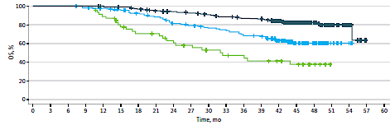
Pre-treatment PSA and Long Term Survival with Doublet Therapy
Post-treatment PSA nadir and Long Term Survival with Doublet Therapy
Armstrong AJ et al JAMA Netw Open 2025

Slide 72
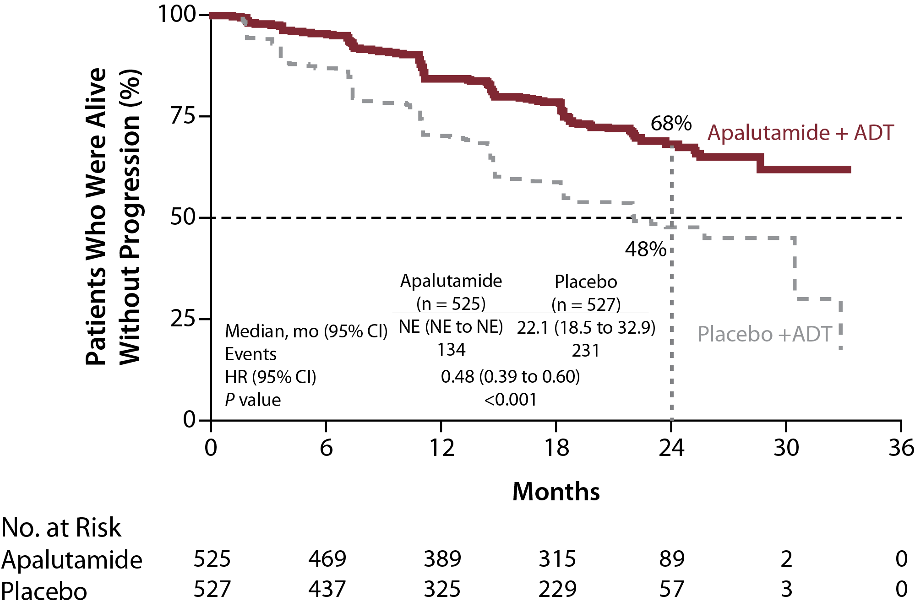
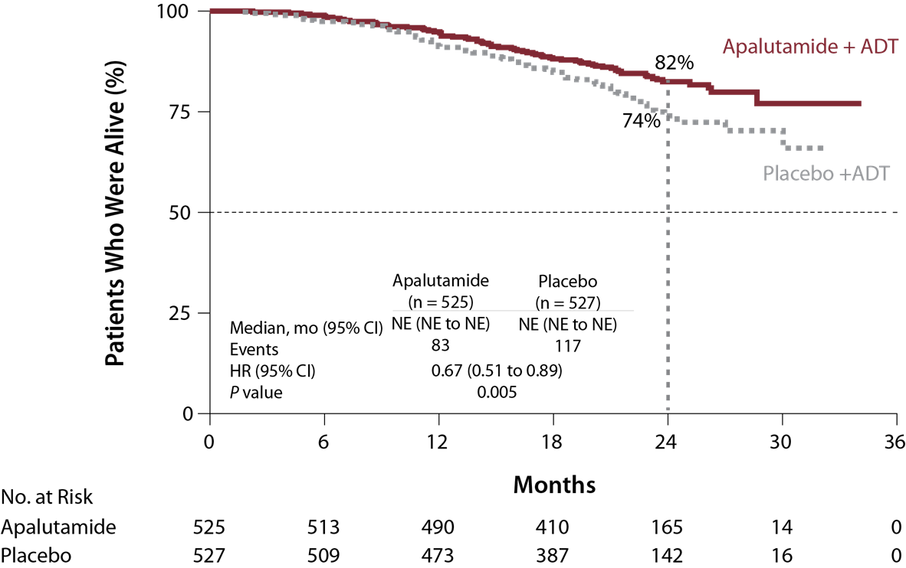
TITAN: Primary Endpoints
rPFS: 52% risk reduction with apalutamide
OS: 33% risk reduction with apalutamide
52%
Relative risk
reduction
33%
Relative risk
reduction
ADT = androgen deprivation therapy; CI = confidence interval; HR = hazard ratio; NE = not estimated; OS = overall survival; rPFS = radiographic progression-free survival.
Chi KN, Agarwal N, Bjartell A, et al. Apalutamide for metastatic, castration-sensitive prostate cancer. N Engl J Med. 2019;381(1):13-24
Notes:
At 24 months, improved rPFS and mOS with apalutamide
GU ASCO update next week will presents the 4 year follow up. In this analysis, patients were unblinded and 40% corssed over to apa. OS was superior to placebo group despite cross over with 4 year OS 65% vs 52% (35% risk reduction, increases to 48% when adjust for corssover) with QOL maintained in apa group
With 44 mos median follow-up, 405 OS events had occurred. After unblinding, 208 PBO pts (39.5%) crossed over to APA. Median treatment duration was 39.3 mos for the APA group, 20.2 mos for the entire PBO group, and 15.4 mos for the PBO→APA crossover group. OS was superior in the APA group compared with the PBO group despite crossover (Table). 48-mo survival rates were 65% (APA) vs 52% (PBO). Other end points also favored APA vs PBO (Table). Healthrelated quality of life (HRQoL), per total FACT-P, was maintained in the APA group through the study and was not different from the PBO group. Safety was consistent with previous reports. Conclusions: With close to 4 yrs of follow-up, the final analysis of TITAN demonstrated that in a broad population of pts with mCSPC, APA plus ADT provides an improvement in OS with a 35% reduction in risk of death, which increased to 48% reduction after adjusting for pts who crossed over from PBO to APA.

Slide 73
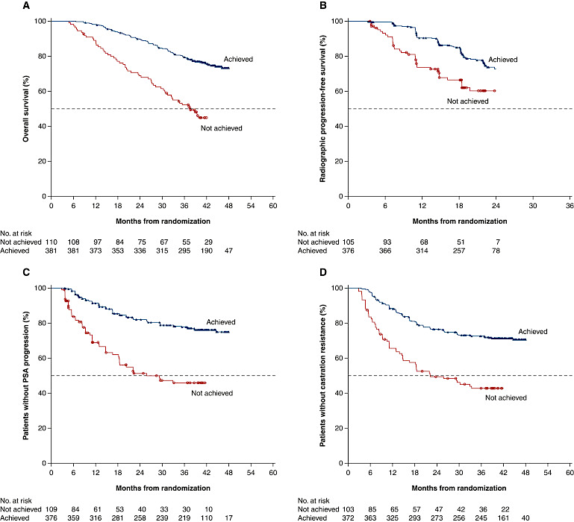
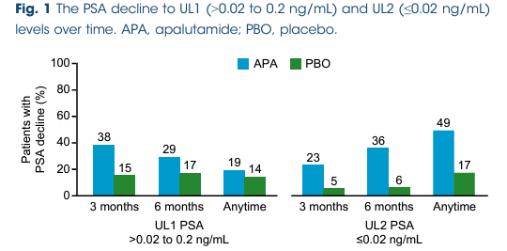
Assessing risk: PSA decline
TITAN (apalutamide)
Deep PSA decline (>90% decline or <0.2ng/mL) at 3 months
Merseburger AS et al BJUI Int 2024
Chowdhury S et al Ann Oncol 2023
Notes:
*reactive
TITAN – apalutamide

Slide 74
Abiraterone vs. Enzalutamide vs. Apalutamide vs Darolutamide
Abiraterone acetate
Enzalutamide, Apalutamide, Darolutamide
Requires prednisone
Mineralocorticoid excess
Liver and electrolyte monitoring required
BP monitoring required
Some CV risk (afib, others)
Bone density monitoring recommended (fracture risk)
Exercise recommended (fatigue, muscle loss)
Beneficial in high and low volume/risk patients
Can be safely given with RT
No prednisone requirement
No mineralocorticoid excess
No liver/electrolyte monitoring required
BP monitoring required
Fatigue, fracture risk
Bone density monitoring recommended (fracture risk)
Exercise recommended (fatigue, muscle loss)
Minimal seizure risk <1%, but careful in patients with h/o seizures, strokes
Apalutamide rash in ~30% can be significant (not enzalutamide)
Beneficial in high and low volume/risk patients
Can be safely given with RT

Slide 76
bicalutamide vs ADT +
enzalutamide

Slide 78
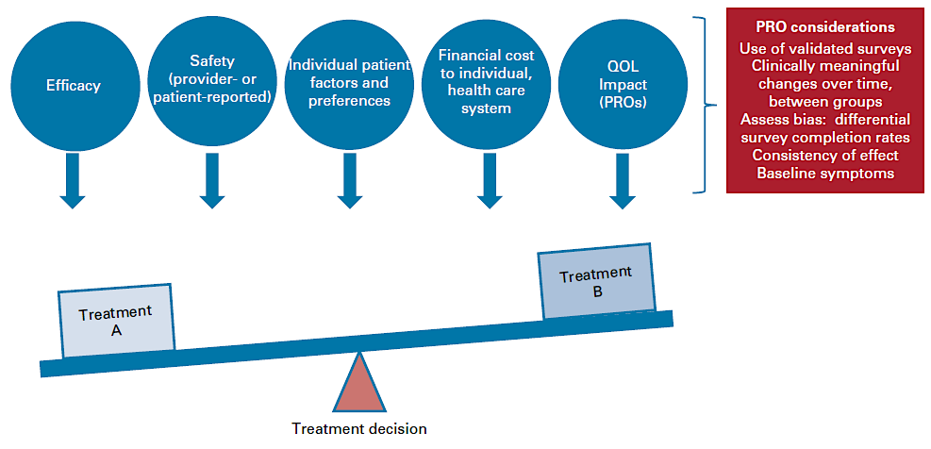
Making the Decision: mHSPC
Dzimitrowicz HE, Armstrong AJ. J Clin Oncol. 2022; 40:807-810

Slide 79
Conclusions
The standard of care for low volume mHSPC based on conventional imaging is doublet ADT/ARPI (LEVEL 1 EVIDENCE, SURVIVAL BENEFIT)
Radiation to the primary for those with synchronous metastases
Radiation to metastatic sites may be beneficial but is presently under study!
STAMPEDE 2 Treatment Arm S: Stereotactic Ablative Body Radiotherapy (SABR), a type of radiotherapy to up to 5 PSMA PET + sites
Emerging/ongoing trials of ARPI/PARPIs (AMPLITUDE, TALAPRO-3, EVOPAR-02), Lu177-PSMA-617 (PSMAddition), AKTi (capivasertib in Capitello-281)
Many patients would love to have a treatment holiday or to stop therapy altogether if remission is achieved in this setting
EMBARK, EXTEND trials establish this proof of concept
New trials are needed to test MDT in the setting of brief ADT/ARPI use in this oligomet HSPC setting with the goal of maintaining survival but extending treatment free intervals!

Slide 80
Faculty Case Presentations

Slide 81
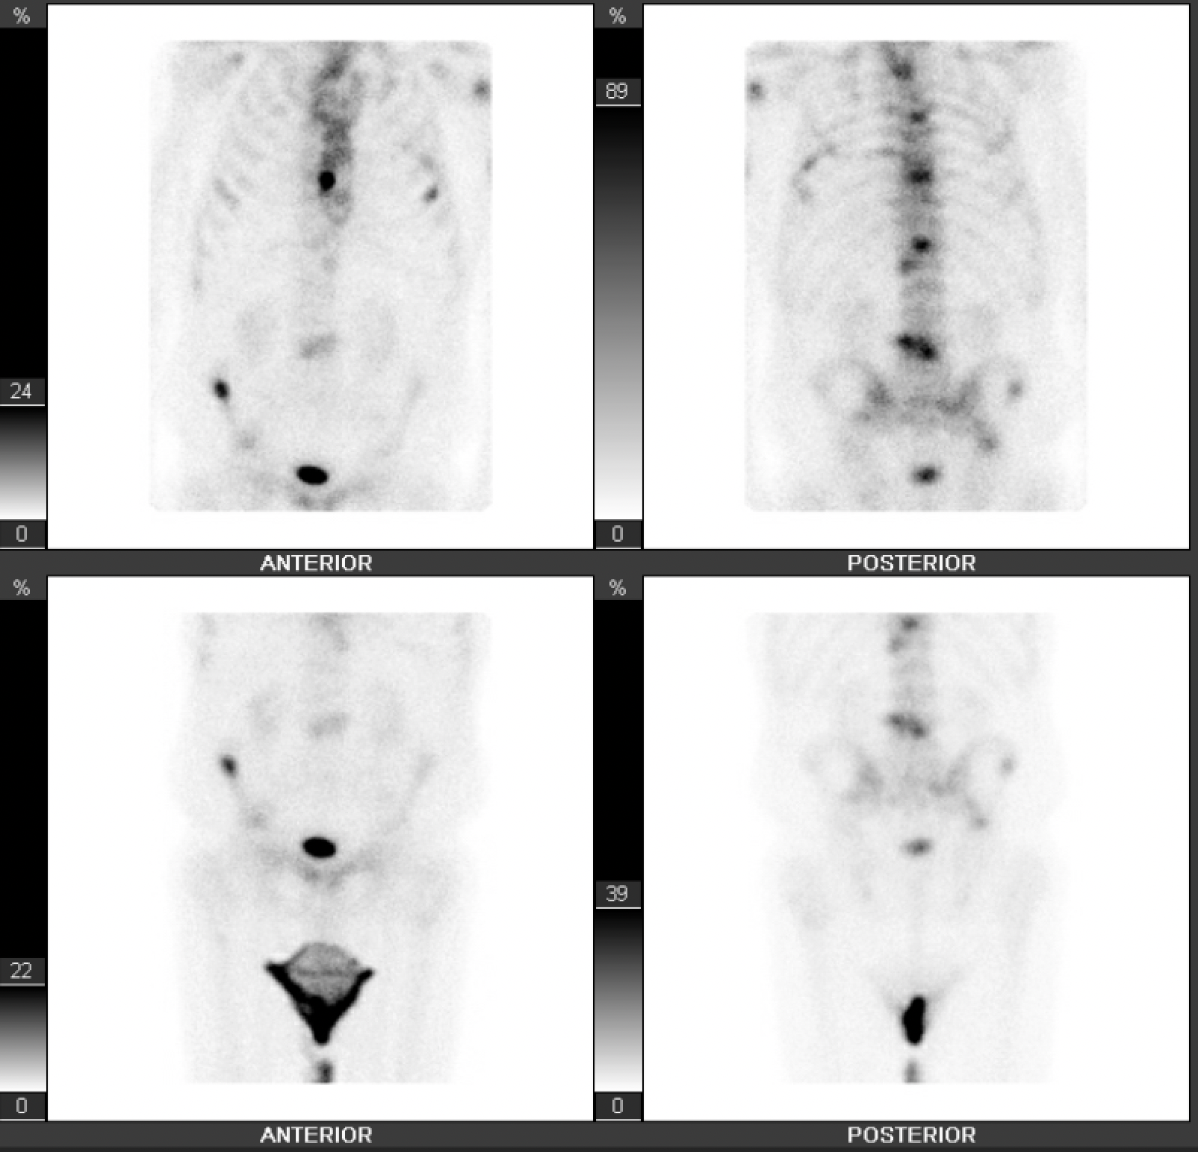
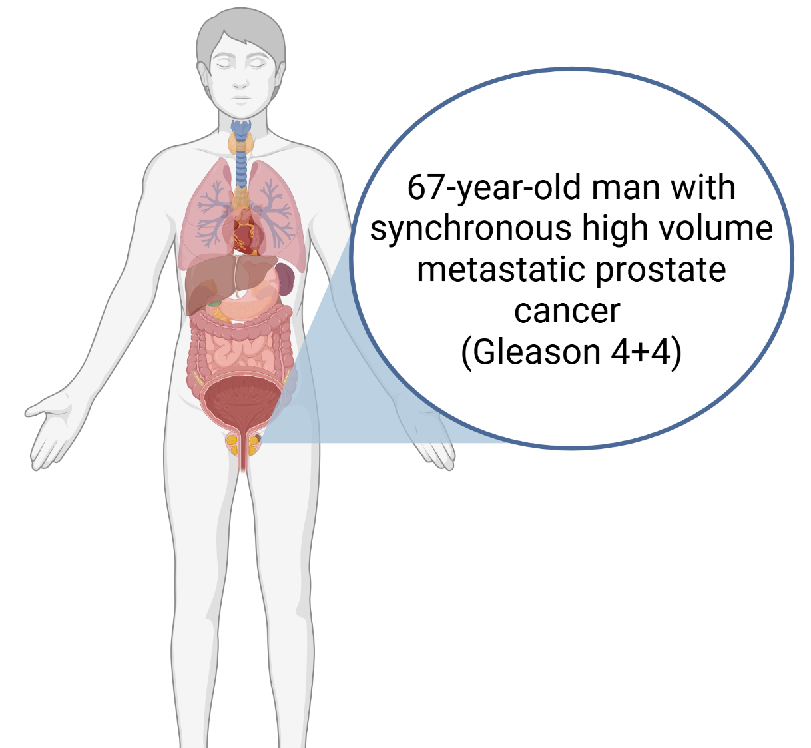
Case Presentation – Dr Agarwal: ADT + Apalutamide in mHSPC
June 2021
Bone scan showing high-volume disease
Notes:
Presented 2021 june 39 months PFS

Slide 82
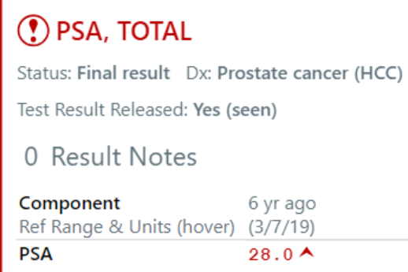
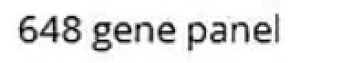
Case Presentation – Dr Agarwal: ADT + Apalutamide in mHSPC (cont’d)
June 2021
At the time of diagnosis

Slide 83
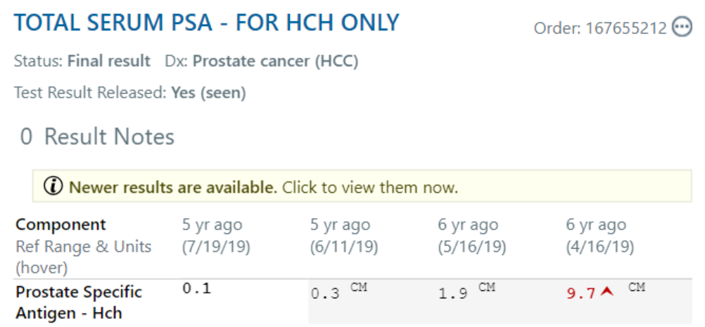
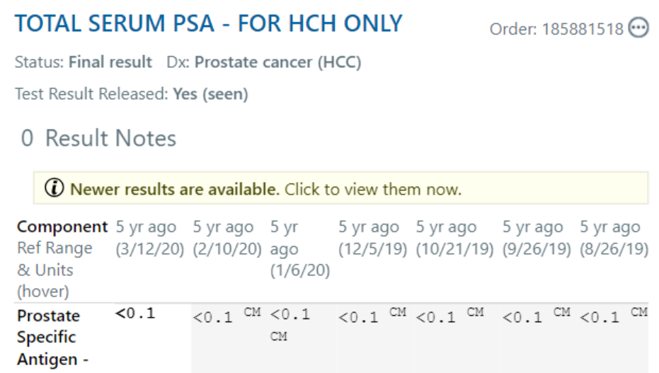
Case Presentation – Dr Agarwal: ADT + Apalutamide in mHSPC (cont’d)
July 2021
Patient started on ADT + Apalutamide
May 2025
The patient achieved an undetectable PSA and is still on the same treatment
Achieved undetectable PSA in <6 months
First PSA after treatment start date

Slide 84
QUESTIONS FOR THE FACULTY
When combining an AR pathway inhibitor with ADT for a patient with mHSPC, do you have a preference for a specific agent? How do you choose among them for individual patients?
Do recent findings suggesting that abiraterone may yield less benefit than enzalutamide or apalutamide for patients aged 75 years or older diminish your enthusiasm for that strategy in older patients?
Would you ever consider a treatment break (similar to the EMBARK strategy in nmHSPC) for a patient such as this with metastatic disease but an undetectable PSA on therapy?

Slide 85
Case Presentation – Dr Beltran: 55 yo gentleman
Presented to PCP and had his first screening PSA.
PSA 664 ng/dL
Feels well overall. Reports frequency and 2-3 x nocturia, no back pain, fatigue, wt changes or other symptoms
Prostate biopsy: Gleason 4+4 prostate adenocarcinoma
PSMA PET : enlarged pelvic and retroperitoneal lymph nodes and high volume of bone metastases and multiple subcm lung lesions
Started on degarelix
He is presenting to discuss additional treatment recommendations
His PSA is now 98 ng/mL with testosterone <10 ng/dL
Otherwise healthy, hx of hypertension controlled on amlodipine and HCTZ

Slide 86
QUESTIONS FOR THE FACULTY
What would you most likely recommend for this patient at this time?
For which types of patients are you prioritizing the combination of ADT/docetaxel/darolutamide over available doublet options? Do you believe all patients with mHSPC who receive cytotoxic therapy should also receive secondary hormonal therapy? Is docetaxel/ADT still an acceptable strategy under any circumstances?
Would you attempt to combine any other secondary hormonal agents (enzalutamide, apalutamide or abiraterone) with docetaxel and ADT for a patient with mHSPC?

Slide 87
Agenda
MODULE 1: Evolving Management of Nonmetastatic Hormone-Sensitive Prostate Cancer (HSPC) — Dr Saad
MODULE 2: Current Treatment for Metastatic HSPC — Dr Armstrong
MODULE 3: Role of PARP Inhibition in Metastatic Castration-Resistant Prostate Cancer (mCRPC) — Dr Agarwal
MODULE 4: Current and Future Use of Radiopharmaceuticals for mCRPC — Dr McKay
MODULE 5: Promising Novel Agents and Strategies Under Investigation for the Management of Prostate Cancer — Dr Beltran

Slide 88
The Role of PARP Inhibition in Metastatic Castration-Resistant
Prostate Cancer
Neeraj Agarwal, MD, FASCO
Professor of Medicine (Medical Oncology)
Senior Director for Clinical Translation, Huntsman Cancer Institute (HCI)
HCI Presidential Endowed Chair of Cancer Research
Director, Center of Investigational Therapeutics
Director, Genitourinary Oncology Program
Huntsman Cancer Institute, University of Utah (NCI-CCC)
Notes:
Show HRR mutation OS from talapro 2 JCO paper – copy paste remind dr agarwal

Slide 89
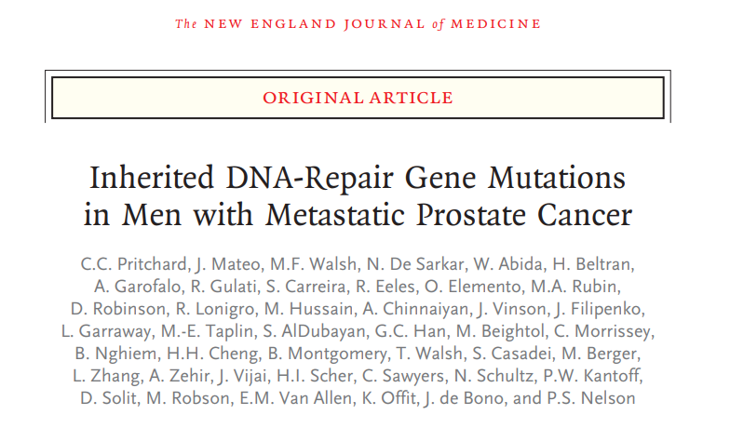
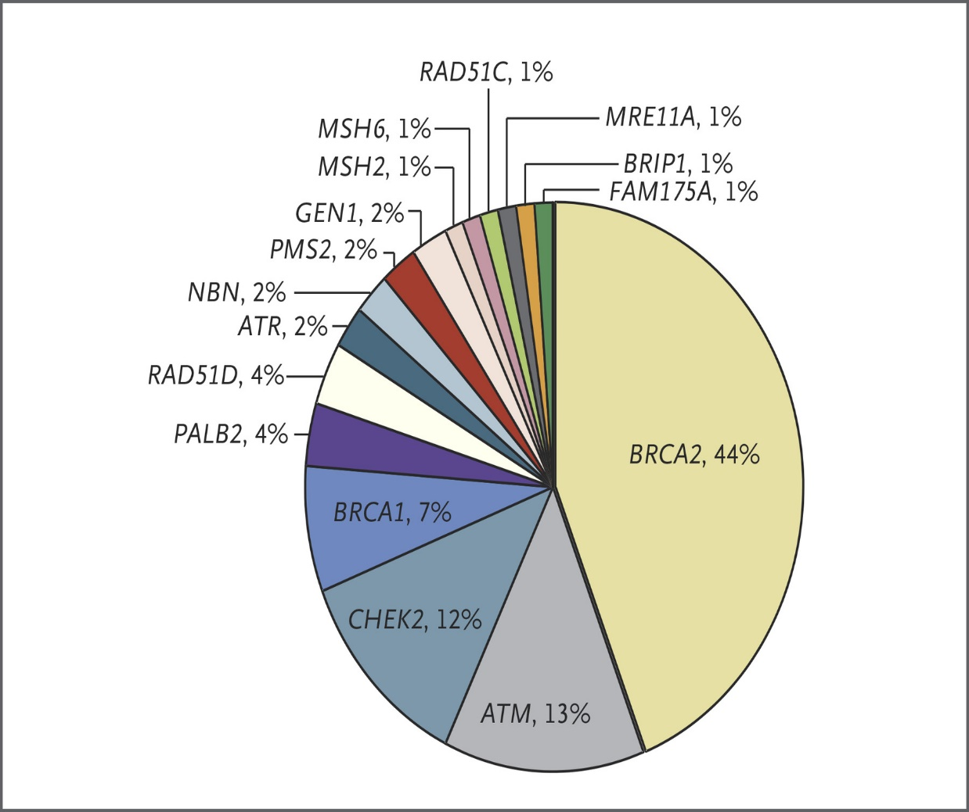
Germline HRR mutations in metastatic prostate cancer
Pritchard et al. NEJM 2016

Slide 90
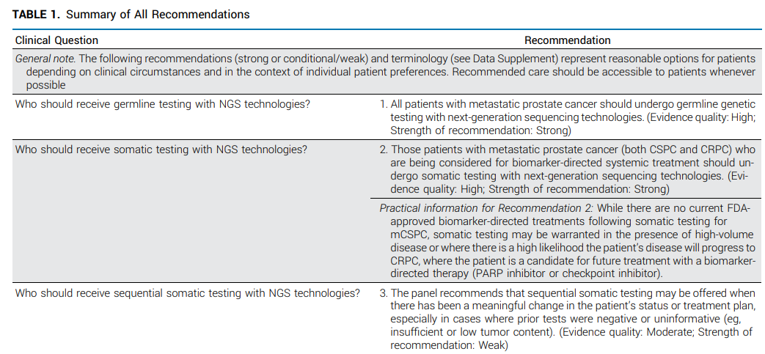
Indications for and practical implementation of genetic testing
Yu et al, JCO, 2025

Slide 91
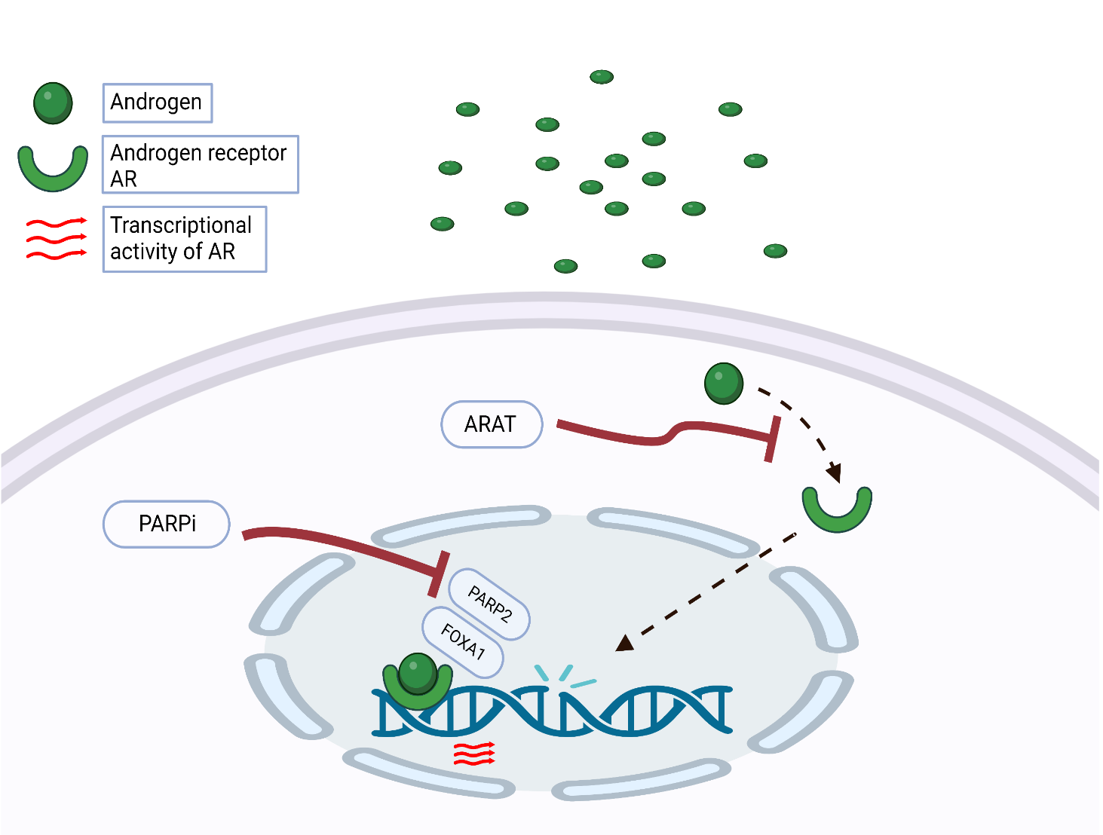
The rationale for combining PARPi with ARPI
ARPIs induce a phenotype resembling HRR deficiency
Suppressed AR function causes an upregulation of PARP
ARPIs prime tumor cells for PARP inhibition
PARP augments AR activity
PARP inhibitors may attenuate resistance to ARPIs
PARP inhibitors extend the benefits of ARPIs
Adapted from Bin Gui et al., PNAS 2019 June, DOI https://doi.org/10.1073/pnas.1908547116
Agarwal N, et al European Journal of Cancer, 2023.
Notes:
AR inhibition upregulate PARP (as a matter of defence) and PARP augments AR activity (trying to negate the action of AR inhibitor).
beyond DNA damage repair function, PARP-2, but not PARP-1, is a critical component in AR transcriptional machinery through interacting with the pioneer factor FOXA1 and facilitating AR recruitment to genome-wide prostate-specific enhancer regions

Slide 92
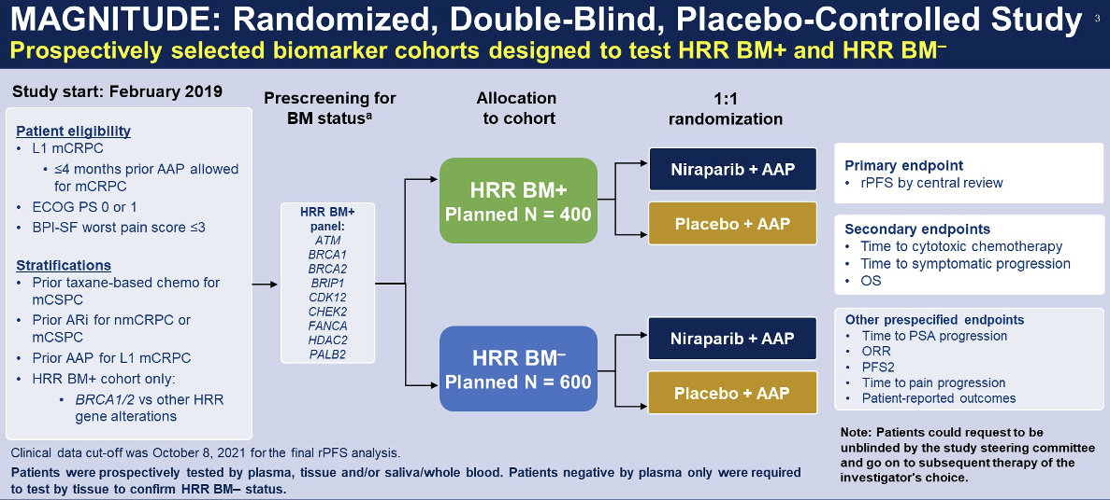
Phase 3 PARPi + ARPI Trials Design
Clarke, NW. et al. NEJM Evidence, 2022
Chi, KN. et al. JCO, 2022
92
Agarwal, N. et al. Lancet, 2023.
Notes:
Add references

Slide 93
Slide 5
Notes:
PROpel is a randomized phase III trial evaluating the efficacy and safety of olaparib + abiraterone versus placebo + abiraterone in the first-line metastatic castration-resistant prostate cancer (mCRPC) setting. Docetaxel therapy was allowed if given in the metastatic castration-sensitive prostate cancer setting. Enrollment in this study was independent of defects in the homologous recombination repair pathway. The primary endpoint was investigator-assessed radiographic Progression-Free Survival (rPFS) with multiple secondary endpoints, including overall survival (OS) and safety. A total of 796 patients were randomized to olaparib + abiraterone (n=399) or placebo + abiraterone (n=397). Baseline characteristics were well-balanced between treatment arms including HRR mutation status.

Slide 94
PROpel primary endpoint: rPFS by investigator-assessment
Notes:
At the pre-planned interim analysis, results show the trial met its primary endpoint with a significant improvement in rPFS for all patients receiving olaparib + abiraterone versus placebo + abiraterone regardless of the presence of homologous recombination repair gene mutations. Median rPFS was 24.8 vs 16.6 months for patients receiving olaparib + abiraterone versus placebo + abiraterone respectively, and a hazard ratio of 0.66, 95% confidence interval 0.54–0.81 and a P value <0.0001, which translates into a 34% reduction in the risk of progression or death.

Slide 95
PROpel: OS at final pre-specified analysis (DCO3)

Slide 96
PROpel: OS in HRRm and non-HRRm subgroups (DCO3)

Slide 97
Slide 3
Notes:
MAGNITUDE is a randomized phase III trial evaluating the efficacy and safety of niraparib + abiraterone versus placebo + abiraterone in the first-line metastatic castration-resistant prostate cancer (mCRPC) setting. Prior taxane in mCSPC or NHT for (nmCRPC or mCSPC) or ≤ 4 months abiraterone in 1st line mCRPC were allowed. Prospective selection of patients with and without homologous recombination repair (HRR) pathway defects was required. The primary endpoint was radiographic Progression-Free Survival (rPFS) by central review with multiple secondary endpoints, including overall survival (OS) and safety.

Slide 98
MAGNITUDE BRCA1/2-mutated: Primary Endpoint<br />NIRA + AAP Significantly Reduced the Risk of Progression or Death by 47%
Notes:
HRR Positive (n=423) patients were randomized to receive either niraparib + abiraterone (n=212) or placebo + abiraterone (n=211). At the pre-planned interim analysis, results show the trial met its primary endpoint with a significant improvement in rPFS for BRCA1/2 and all homologous recombination repair mutation positive patients receiving niraparib + abiraterone versus placebo + abiraterone. Overall survival results are still immature. It is important to note that in the HRR positive cohort of patients, approximately 50% were BRCA1/2 positive and that these patients clearly derived the most benefit from the combination with an approximate 47% reduction in the risk of progression or death. Median rPFS in the biomarker positive BRCA1/2 subgroup was 16.6 vs 10.9 months with a HR 0.53, 95% CI: 0.36 – 0.79; P=0.0014.

Slide 99
MAGNITUDE All HRR BM+: Primary Endpoint<br />NIRA + AAP Significantly Reduced the Risk of Progression or Death by 27%
Notes:
While benefit in all biomarker positive patients had a median rPFS of 16.5 versus 13.7 months with a HR of 0.73, 95% CI: 0.56 – 0.96 and P value = 0.217, which translates to a 27% reduction in the risk of progression or death.

Slide 100
MAGNITUDE All HRR BM+: Overall Survival <br />First Interim Analysis With Median Follow-up of 18.6 Months
Notes:
Overall survival results are still immature with only 27% events in the study population reported to date.

Slide 102
TALAPRO-2: Trial Design
Patient population
1L mCRPC
ECOG 0 or 1
Ongoing androgen deprivation therapy
Stratification factors
Prior abirateroneª or docetaxel for CSPC (yes vs no)
HRR gene alteration status (deficient vs non-deficient or unknown)^{b}
Primary endpoint
rPFS by BICR
Talazoparib + enzalutamide
(N=402)
Key secondary endpoint
OS (alpha protected)
Other secondary endpoints
Time to cytotoxic chemotherapy
PFS2
ORR
Patient-reported outcomes
Safety
1:1
Unselected Cohort 1 (N=805)
Placebo + enzalutamide (N=403)
Sequential enrollment in two cohorts:
Unselected (Cohort 1), N=805
Samples prospectively assessed for HRR gene alterations (ATM, ATR, BRCA1, BRCA2, CDK12, CHEK2, FANCA, NBN, MLH1, MRE11A, PALB2, RAD51C)
HRRm
N=169
Non-deficient or unknown
N=636
HRRm
N=230
DCO1: Aug 16, 2022
rPFS (primary)
DCO2: March 28, 2023
OS (interim)
DCO3: Sept 3, 2024
OS (final) current
HRRm only (Cohort 2), N=399
Analysis timeline:
(unselected)
ªPrior orteronel was received by two patients in each treatment arm in Cohort 1 and one patient in each treatment arm in Cohort 2. ^{b}Unselected cohort only.
BICR=blinded independent central review; CSPC=castration-sensitive prostate cancer; DCO=data cutoff; ORR=objective response rate; PFS2=time to second progression or death.
Professor Neeraj Agarwal
Notes:
Enrolled patients had not received prior systemic therapy for castration-resistant disease.
In the unselected Cohort 1, randomization was stratified by prior abiraterone or docetaxel in the castration-sensitive setting, and by HRR gene alteration status defined as deficient versus non-deficient plus unknown.
All patients were prospectively assessed for HRR gene alterations.
Overall survival was an alpha-protected key secondary endpoint.
Here, we report results from the final prespecified overall survival analysis, a descriptive update of rPFS, and other secondary endpoints including extended safety follow-up and quality of life in the unselected population.
Build:
Data for the HRR-deficient cohort 2 is being presented today by Dr Karim Fizazi in the poster session.

Slide 103
TALAPRO-2 Unselected
Primary Endpoint: rPFS by BICR
Statistically significant and clinically meaningful benefit maintained with ~2 years of additional follow-up
Primary analysis (DCO: Aug 16, 2022)¹
Update (DCO: Sept 3, 2024)
 | Events/ patients | Median rPFS (95% CI), mo | Median follow-up, mo
TALA + ENZA | 151/402 | NR (27.5–NR) | 24.9
PBO + ENZA | 191/403 | 21.9 (16.6–25.1) | 24.6
 | Events/ patients | Median rPFS (95% CI), mo | Median follow-up, mo
TALA + ENZA | 202/402 | 33.1 (27.4–39.0) | 47.0
PBO + ENZA | 231/403 | 19.5 (16.6–24.7) | 46.9
1.0
1.0
0.8
0.8
0.6
0.6
13.6 months improvement
Probability of rPFS
Probability of rPFS
0.4
0.4
0.2
0.2
HR=0.627 (0.506–0.777); P<0.0001
HR=0.667 (0.551–0.807); P<0.0001ª
0.0
0.0
0
4
8
12
16
20
24
28
32
36
40
44
48
52
56
60
64
68
0
4
8
12
16
20
24
28
32
36
40
44
48
52
56
60
64
68
No. at risk
Time (Months)
No. at risk
Time (Months)
TALA + ENZA
402
353
318
256
226
193
136
67
29
2
1
0
0
0
0
0
0
0
TALA + ENZA
402
353
318
257
228
196
180
155
138
122
108
101
63
50
13
7
1
0
PBO + ENZA
403
311
272
200
179
140
96
43
14
1
1
0
0
0
0
0
0
0
PBO + ENZA
403
312
273
201
180
138
128
100
92
81
72
66
44
35
5
2
1
0
Stratified hazard ratios (HRs) and 2-sided P values are reported throughout this presentation unless otherwise stated.
ªThe updated rPFS data are descriptive. DCO=data cutoff; ENZA=enzalutamide; NR=not reached; PBO=placebo; TALA=talazoparib. 1. Reproduced with permission from Agarwal N, et al. Lancet. 2023;402:291-303.
Professor Neeraj Agarwal
Notes:
For the primary endpoint, the statistically significant and clinically meaningful improvement in rPFS was maintained after approximately 4 years of follow-up.
At the updated analysis, there was a 33% reduction in risk of progression or death with talazoparib plus enzalutamide versus placebo plus enzalutamide. Median rPFS was 33.1 months in the combination arm versus 19.5 months in the control group: an improvement of 13.6 months with the addition of talazoparib.
--------------
Reprinted from The Lancet, 402, Agarwal et al, Talazoparib plus enzalutamide in men with first-line metastatic castration-resistant prostate cancer (TALAPRO-2): a randomised, placebo-controlled, phase 3 trial , Pages No. 291–303, Copyright (2023), with permission from Elsevier.

Slide 104
TALAPRO-2 Unselected
Overall Survival (Final Analysis)
20.4% reduction in risk of death, >8 months improvement in median OS
1.0
 | Events/patients | Median OS (95% CI), mo
TALA + ENZA | 211/402 | 45.8 (39.4–50.8)
PBO + ENZA | 243/403 | 37.0 (34.1–40.4)
0.8
0.6
Probability of OS
8.8 months improvement
0.4
Median follow-up for OS was 52.5 months
0.2
HR=0.796 (0.661–0.958); P=0.0155
0.0
0
4
8
12
16
20
24
28
32
36
40
44
48
52
56
60
64
68
No. at risk
Time (Months)
TALA + ENZA
402
390
371
347
319
296
285
250
226
212
193
183
158
89
42
11
1
0
PBO + ENZA
403
391
362
331
305
287
257
231
207
183
163
148
127
77
33
4
1
0
For statistical significance at the final overall survival analysis, the stratified log-rank 2-sided P value needed to be ≤0.022 based on a group sequential design with O’Brien-Fleming spending function.
Data cutoff: September 3, 2024.
Professor Neeraj Agarwal
Notes:
At this final overall survival analysis, there was a statistically significant 20% reduction in the risk of death favoring talazoparib plus enzalutamide.
Median overall survival was 45.8 versus 37 months showing an improvement of 8.8 months with talazoparib plus enzalutamide.
To our knowledge, this is the longest median OS reported in a patient population in a randomized clinical trial in the mCRPC setting.

Slide 105
TALAPRO-2 Unselected
Overall Survival in Subgroups With No Alterations Detected by
Both ctDNA and Tumor Tissue
Clinically meaningful reduction in risk of death in patients without BRCA or HRR alterations
No BRCA alteration detected
No HRR alteration detected
 | Events/ patients | Median OS (95% CI), mo
TALA + ENZA | 114/219 | 48.4 (37.2–54.1)
PBO + ENZA | 137/220 | 37.1 (31.1–40.7)
 | Events/ patients | Median OS (95% CI), mo
TALA + ENZA | 82/154 | 46.6 (33.0–54.1)
PBO + ENZA | 99/160 | 37.4 (30.0–40.9)
1.0
1.0
0.8
0.8
11.3 months improvement
9.2 months improvement
0.6
0.6
Probability of OS
Probability of OS
0.4
0.4
0.2
0.2
HR=0.749 (95% CI, 0.582–0.963); P=0.0237ª
HR=0.782 (0.582–1.050); P=0.1008ª
0.0
0.0
0
4
8
12
16
20
24
28
32
36
40
44
48
52
56
60
64
68
0
4
8
12
16
20
24
28
32
36
40
44
48
52
56
60
64
68
No. at risk
Time (Months)
No. at risk
Time (Months)
TALA + ENZA
219
213
204
187
172
159
155
135
123
114
102
99
89
51
26
7
1
0
TALA + ENZA
154
148
142
128
120
110
108
95
85
79
72
71
64
36
19
5
1
0
PBO + ENZA
220
214
196
179
164
155
135
121
110
98
84
75
63
39
20
1
1
0
PBO + ENZA
160
156
143
131
120
113
97
87
81
73
61
53
44
29
14
1
1
0
Post hoc analysis employing all available test results of prescreening/screening samples including both prospective and retrospective analyses.
Data cutoff: September 3, 2024. ªReported P values are nominal and descriptive.
Professor Neeraj Agarwal
Notes:
We addressed the ambiguity associated with an unknown status by conducting a rigorous post hoc analysis using a stringent definition of HRR or BRCA gene alteration status in both liquid and tumor biopsies.
In patients without BRCA alteration by both liquid and tumor biopsies, the hazard ratio for death was 0.749 favoring talazoparib plus enzalutamide.
In patients who did not have any HRR gene alterations by both ctDNA and tumor tissue testing, the hazard ratio was 0.782 favoring the combination, with a median improvement of over 9 months with talazoparib plus enzalutamide.

Slide 106
Final Overall Survival Analysis in Patients with any HRR Gene Alterations (HRR-deficient Intention-to-Treat Population)
CI=confidence interval; ENZA=enzalutamide; HR=hazard ratio; HRR=homologous recombination repair; mo=months; NR=not reached; PBO=placebo; TALA=talazoparib
Fizazi, K et al. J Clin Oncol. 2025;43(suppl 5):Abstract LBA141.

Slide 107
FDA’s Oncologic Drugs Advisory Group Unanimously Voted Against Broad Label Expansion for Talazoparib in Combination with Enzalutamide for Patients with mCRPC
On May 21, 2024, the FDA’s Oncologic Drugs Advisory Committee unanimously voted that the data from TALAPRO-2 investigating talazoparib in combination with enzalutamide were not sufficient to conclude a favorable benefit-risk profile for patients with mCRPC not selected for homologous recombination repair (HRR) gene alterations.
The committee expressed concerns over the trial design and the toxicity of this regimen for this population.
The FDA previously approved talazoparib + enzalutamide combination therapy for patients with HRR-positive mCRPC on June 20, 2023. Approval for this therapy was supported with the data from the TALAPRO-2 trial (NCT03395197).
https://www.fda.gov/media/186563/download

Slide 108
Phase 3 Combination trials of PARP inhibitors with an ARPI
 | PROpel (N = 796) | MAGNITUDE (N = 423) | TALAPRO-2 (Cohort 1: N = 805) | TALAPRO-2 (Cohort 2: N = 399)
Trial population mCRPC 1st line | Docetaxel / ARSI in mCSPC setting allowed (ARSI without progression and > 12 months ago) | Docetaxel / ARSI in mCSPC setting allowed ; Abiraterone in mCRPC allowed if given < 4 months | Docetaxel / Abiraterone in mCSPC setting allowed | Yes (abiraterone only)
Design and randomization | 1 : 1 randomisation Abiraterone + olaparib (n = 399) vs abiraterone + placebo (n = 397) | Cohort 1: HRR cohort 1 : 1 randomisation abiraterone + niraparib (n = 212) vs abiraterone + placebo (n = 211) Cohort 2: non-HRR cohort (closed prematurely because of futility) | All-comer population 1 : 1 randomisation Enzalutamide + talazoparib (n = 402) vs enzalutamide + placebo (n = 403) | HRR cohort 1 : 1 randomisation Enzalutamide + talazoparib (n = 200) vs enzalutamide + placebo (n = 199)
HRR analysis | Tissue or ctDNA / retrospective | 100% tissue / prospective | 100% tissue / prospective | 99.5% tissue / prospective 0.5% ctDNA or unspecified tissue source / prospective
Primary endpoint | rPFS (investigator review) | rPFS (central review) | rPFS (central review) | rPFS (central review)
rPFS, HR (95% CI)
All comers | HR 0.66 (0.54-0.81) | NR | HR 0.63 (0.51-0.78) | Not included
HRR -ve | HR 0.76 (0.6-0.97) | HR 1.09 (0.75-1.57) | HR 0.70 (0.54-0.89) | Not included
HRR +ve | HR 0.50 (0.34-0.73) | HR 0.73 (0.56-0.96) | HR 0.46 (0.30-0.70) | HR 0.45 (0.33-0.61)
BRCA+ | HR 0.23 (0.12-0.43) | HR 0.53 (0.36-0.79) | HR 0.23 (0.10-0.53) | HR 0.20 (0.11-0.36)
ORR (all comers) | 58% vs 48% | 60% vs 28% (only HRR+ pts) | 61.7% vs 43.9% | 67% vs 40%
OS (all comers) | HR 0.81 (0.67-1) | HR 0.66 (0.46-0.95) (only for BRCA 1/2) | HR 0.80 (0.66–0.96) | HR 0.62 (0.48–0.81)
FDA approval; EMA approval | mCRPC with BRCA1/2 mutations; mCRPC when chemotherapy is not indicated | mCRPC with BRCA1/2 mutations | mCRPC with any HRR mutations; mCRPC when chemotherapy is not clinically indicated
Publication | Clarke N….Saad F. NEJM Evidence, 2022 | Chi K….Sandhu S. JCO, 2023 | Agarwal N….Fizazi K. Lancet, 2023 | Fizazi K….Agarwal N. Nature medicine, 2023
Notes:
Cohort 1

Slide 109
Abstract # 19<br />BRCAAway: A Randomized Phase 2 Trial of Abiraterone, Olaparib, or Abiraterone + Olaparib in Patients with Metastatic Castration-Resistant Prostate Cancer (mCRPC) bearing Homologous Recombination-Repair Mutations (HRRm)

Slide 110
Progression-Free Survival (PFS)

Slide 111
Median PFS from Randomization to End of Crossover Treatment
Arm 1: Abiraterone → Olaparib
16 mo
Arm 2: Olaparib → Abiraterone
16 mo
Arm 3: Abiraterone + Olaparib
39 mo
Time Since Randomization, Months
Hussain M., ASCO GU 2024

Slide 112
AMPLITUDE (Niraparib): Phase 3 Trial Design (mHSPC)
Key Eligibility
Men aged ≥ 18 years with confirmed mHSPC (adenocarcinoma)
Metastatic disease documented by greater than or equal to (>=) 1 bone lesion(s)
Positive for deleterious germline or somatic homologous recombination repair (HRR) gene mutations
Radiation with curative intent or prior treatment with PARPi is not allowed
Patients with long-term use of systemically administered corticosteroids or history of MDS or AML were excluded
R A N D O M I Z E D
n=788
Niraparib 200 mg qd +
Abiraterone Acetate
1000 mg qd.
+
Prednisone 5 mg qd
Efficacy end points
Primary:
rPFS per PCWG 3
Secondary:
OS
Symptomatic PFS
Time to subsequent therapy
Duration of response (DOR)
Number of Participants with Adverse Events as a Measure of Safety and Tolerability
Placebo
+
Abiraterone Acetate
1000 mg qd.
+
Prednisone 5 mg qd
www.clinicaltrials.gov: (NCT04497844)
Rathkopf et al., 2021, ABSTRACT TPS 176 ASCO-GU
Notes:
The AMPLITUDE trial, is investigating a combination of niraparib plus abiraterone versus placebo plus abiraterone. This study plans to recruit a total of 788 patients with metastatic castration-sensitive prostate cancer with a known DNA repair gene defect status. The primary endpoint is radiographic PFS.

Slide 113
TALAPRO-3 (Talazoparib): Phase 3 Trial Design (mHSPC)
Key Eligibility
Men aged ≥ 18 years with confirmed mHSPC (adenocarcinoma)
Metastatic disease documented by greater than or equal to (>=) 1 bone or soft tissue lesion(s)
Positive for deleterious germline or somatic homologous recombination repair (HRR) gene mutations
Radiation/surgery with curative intent or prior treatment with chemotherapy or PARPi is not allowed
Patients with brain metastases or a history of MDS or AML were excluded
R A N D O M I Z E D
n=550
Talazoparib 0.5 mg/day
(0.35 mg/day [PO]
if moderate renal
impairment)
+
open-label enzalutamide
160 mg/day (PO)
Efficacy end points
Primary:
rPFS
Secondary:
OS
ORR
PSA response
Health-related quality of life
Placebo
+
open-label enzalutamide
160 mg/day (PO)
www.clinicaltrials.gov: (NCT04821622)
1 Agarwal et al., 2022, ABSTRACT TPS 221 ASCO-GU
Notes:
The TALAPRO-3 trial, is investigating a combination of talazoparib plus enzalutamide versus placebo plus enzalutamide. This study plans to recruit a total of 550 patients with metastatic castration-sensitive prostate cancer with a known DNA repair gene defect status. The primary endpoint is radiographic PFS.

Slide 114
EvoPAR-Prostate01: Phase 3 Trial Design (mHSPC)
A Phase III, 2-cohort, 2-arm, randomized, double-blind, placebo-controlled study evaluating the efficacy and safety of saruparib plus physician’s choice of NHA (abiraterone, darolutamide, or enzalutamide) versus placebo plus physician’s choice of NHA in participants with mCSPC
Eligibility criteria
≈550 patients
Saruparib 60 mg plus physician’s choice NHA
Select endpoints
HRRm
HRRm cohort
rPFS
OS
Non-HRRm cohort
rPFS
OS
Aged ≥18 years
Histologically confirmed mCSPC (de novo or recurrent low- or high-volume disease)
ECOG PS 0–1
Prospectively defined HRRm status*
Must be receiving ADT throughout the study or have undergone bilateral orchiectomy, and must be suitable for treatment with NHAs
No prior treatment with PARP inhibitors, CT, or NHAs in the metastatic setting†
No suspected or prior history of myelodysplastic syndrome/acute myeloid leukemia
R 1:1
Placebo plus physician’s choice NHA
No crossover between cohorts
Saruparib 60 mg plus physician’s choice NHA
Statistical analyses
Non-HRRm
rPFS and OS will be tested for each cohort separately using a stratified log-rank test
R 1:1
Placebo plus physician’s choice NHA
≈1250 patients
Treatment will continue until disease progression, unacceptable toxicity, or participant-initiated withdrawal
www.clinicaltrials.gov: (NCT06120491)
Agarwal N. et al, AUA 2024

Slide 115
My take on PARPi plus ARPI in mCRPC
Many patients with new mCRPC will not have disease progression on a prior ARPI in the next 5-7 years: 1) patients progressing from localized prostate cancer with BCR, 2) patients with locally advanced prostate cancer receiving limited duration ARPI, and 3) patients with mHSPC not receiving ARPI at all or until progression
How I select a given combination: 1) For new mCRPC with BRCA1/2 mutations, I use the PARPi combinations based on my selection of the partner ARPI; 2) For new mCRPC with non-BRCA1/2 HRRm, I use enzalutamide plus talazoparib
Based on the results of the BRCAAway trial, the upfront combination of an ARPI+PARPi seems more efficacious than the sequencing of ARPI followed by a PARPi
All patients with advanced prostate cancer should undergo tumor genomic profiling and germline testing
Next steps:
Elucidation of the mechanism of response in HRRm-negative patients
Mechanism of resistance to PARPi

Slide 116
Faculty Case Presentations

Slide 117
Case Presentation – Dr Beltran: 69 yo gentleman
Diagnosed with T3aN0M0 Gleason 4+5 prostate adenocarcinoma 4 years ago, PSA 15ng/ml
Treated with radiation plus 2 years of ADT , PSA nadir 0.3 , testo <3 ng/dL
He came off ADT but was then lost to follow-up and has not had regular PSA checks
Presents now with PSA 10 ng/ml, testosterone 10 ng/dL
Imaging shows multiple bone metastases
He feels well, asymptomatic
PMH is notable for HTN, hyperlipidemia- well controlled
Family history notable for a sister and maternal aunt with breast cancer in 50s
Genetic testing identified a pathogenic germline BRCA2 mutation

Slide 118
QUESTIONS FOR THE FACULTY
What would you recommend next for this patient?
Are there any situations in which you would currently attempt to access olaparib/abiraterone or niraparib/abiraterone outside of a clinical trial for a patient with mCRPC and an HRR mutation other than BRCA?
Outside of a clinical trial, would you currently administer a PARP inhibitor in combination with an AR pathway inhibitor for a patient with mCRPC without a documented HRR gene mutation?

Slide 119
QUESTIONS FOR THE FACULTY
How do you approach the use of PARP inhibitor-based combinations in patients with mCRPC who have already received a novel antiandrogen in an earlier disease setting? Would you consider a PARP inhibitor in combination with the same or an alternate secondary hormonal agent in such a scenario, or would you favor PARP inhibitor monotherapy?

Slide 120
Case Presentation – Dr Saad: 72-year-old patient
In 2014 at age 61 diagnosed with cT3, Gleason 8 prostate cancer, PSA 42
Treated with radiation therapy and 3 years of ADT
PSA undetectable in 2017
In 2019 PSA was up to 4.5 with a PSADT of 6 months
Negative metastatic work-up
Put on ADT in 2019
Did well until 2023 when PSA rose to 5.5
Imaging revealed metastases to lymph nodes and bone
Lymph node biopsy revealed a BRCA2 mutation in May 2023

Slide 121
Case Presentation – Dr Saad: Patient with newly diagnosed mCRPC with a BRCA mutation
Patient well informed and accepted abiraterone + niraparib
PSA decline from 8.1 to 2.3 after 1 month of treatment
At week 8
Symptomatic anemia with HB declining from 12.2 to 8.7
Niraparib suspended and transfused 1 unit
1 week later was put back on niraparib at reduced dose (100mg)
Update April 2025
PSA is undetectable (< 0.02) and CR of measurable disease
Continues to do very well on treatment

Slide 122
QUESTIONS FOR THE FACULTY
What outcomes from ongoing Phase III trials of PARP inhibitors in mHSPC would prompt you to employ them in that setting? What would you be looking for in terms of hazard ratios/advantages in PFS or OS?
If PARP inhibitors eventually reach the clinic for mHSPC, how would you select between this strategy and triplet therapy with an AR pathway inhibitor, docetaxel and ADT?
For how long would you likely administer the PARP inhibitor if these agents were available for mHSPC? How concerned are you about the risk of MDS/AML with prolonged use?

Slide 123
Agenda
MODULE 1: Evolving Management of Nonmetastatic Hormone-Sensitive Prostate Cancer (HSPC) — Dr Saad
MODULE 2: Current Treatment for Metastatic HSPC — Dr Armstrong
MODULE 3: Role of PARP Inhibition in Metastatic Castration-Resistant Prostate Cancer (mCRPC) — Dr Agarwal
MODULE 4: Current and Future Use of Radiopharmaceuticals for mCRPC — Dr McKay
MODULE 5: Promising Novel Agents and Strategies Under Investigation for the Management of Prostate Cancer — Dr Beltran

Slide 124
Current and Future Use of Radiopharmaceuticals in mCRPC
Rana R. McKay, MD, FASCO
Professor of Medicine and Urology
Moores Cancer Center, University of California San Diego

Slide 125
Radiopharmaceuticals

Slide 126
Heterogeneity of Agents
Targeting Molecule
Linker
Radioactive Isotope
Target | Carrier Systems | Linkers | Radiation Types
PSMA | Small molecule | Chelators – DOTA, DOTAGA | β – Lu-177, I-131, Cu-67
KLK2 | Peptides | Chemical – Hydrocarbon, PEG, Peptide, Cleavable | α – Ac-225, Ra-223, Th-227
STEAP 1/STEAP 2 | Antibodies
DLL3 | Nucleic acid
 | Nanoparticles

Slide 127
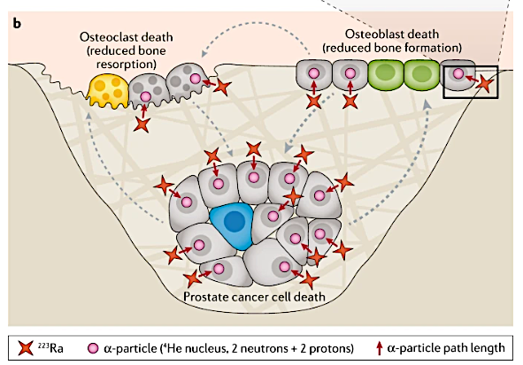
Mechanisms of Action of Radium-223

Slide 128
ALSYMPCA Trial
Double-Blind, Placebo-Controlled Randomized Phase III Study
Metastatic CRPC
ECOG 0-2
Received, decline, or not eligible for docetaxel
≥2 bone metastases
Symptomatic disease (analgesic use or prior XRT within 12 months)
Excluded if >3 cm LN, visceral metastases, spinal cord compression
Radium-223 50 kBq/kg IV q4 weeks x 6
N=614
Placebo
N=307
2:1
Primary Endpoint: Overall Survival
Parker et al, NEJM, 2013

Slide 129
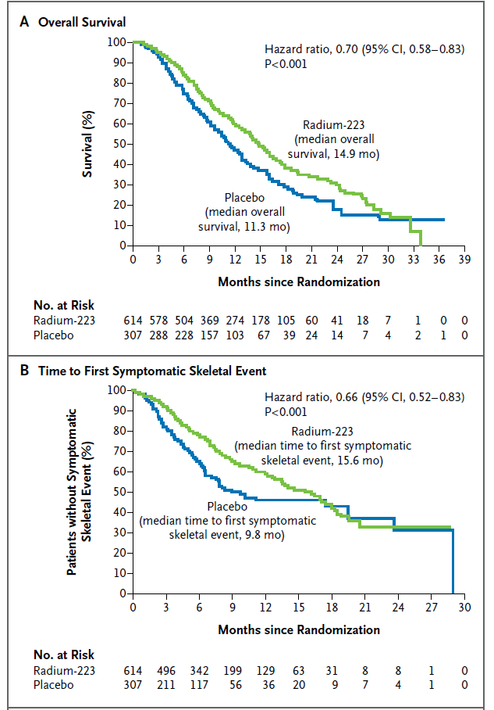
ALSYMPCA Trial
Parker et al, NEJM, 2013

Slide 130
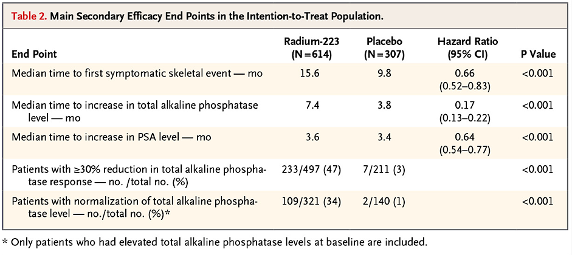
ALSYMPCA Secondary Endpoints
Parker et al, NEJM, 2013

Slide 131
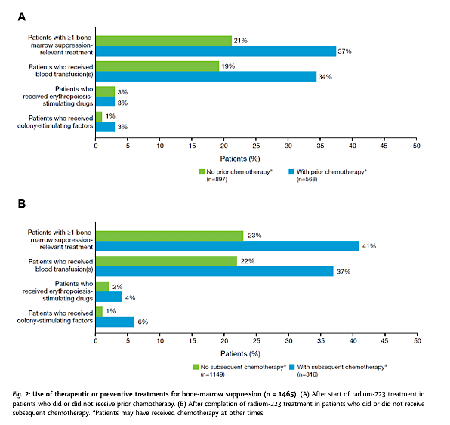
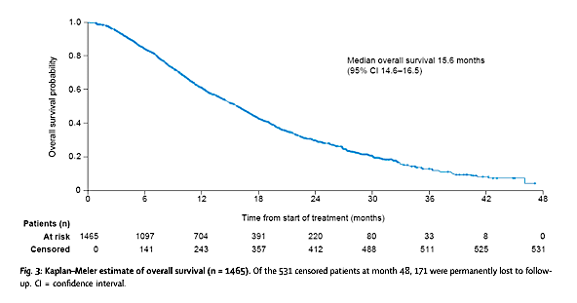
REASSURE – Real World Observational Study Radium-223
Higano et al, Lancet, 2023

Slide 132
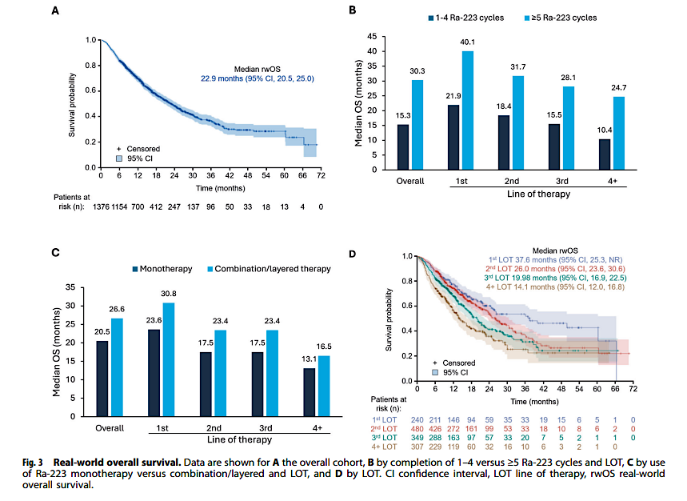
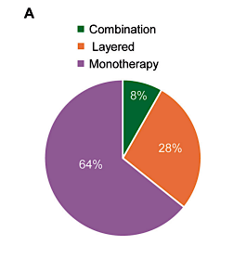
Real World Radium-223 Outcomes
Retrospective analysis of 1376 patients treated with radium-223
Raval et al, PCPD, 2025

Slide 133
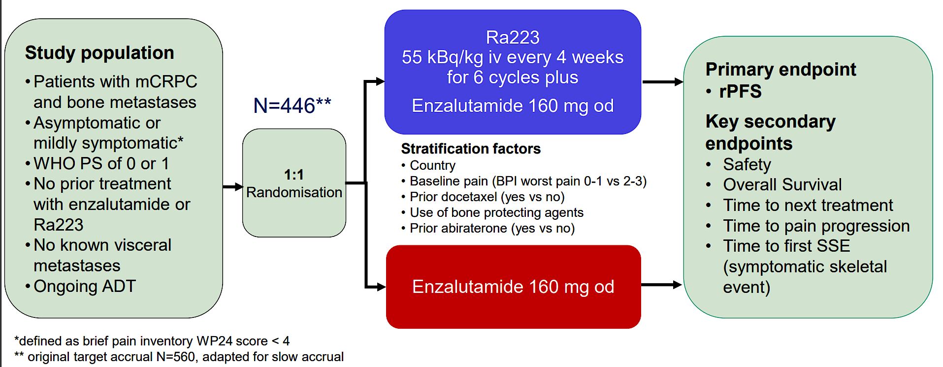
PEACE III Design
Gillessen et al, ESMO, 2024

Slide 134
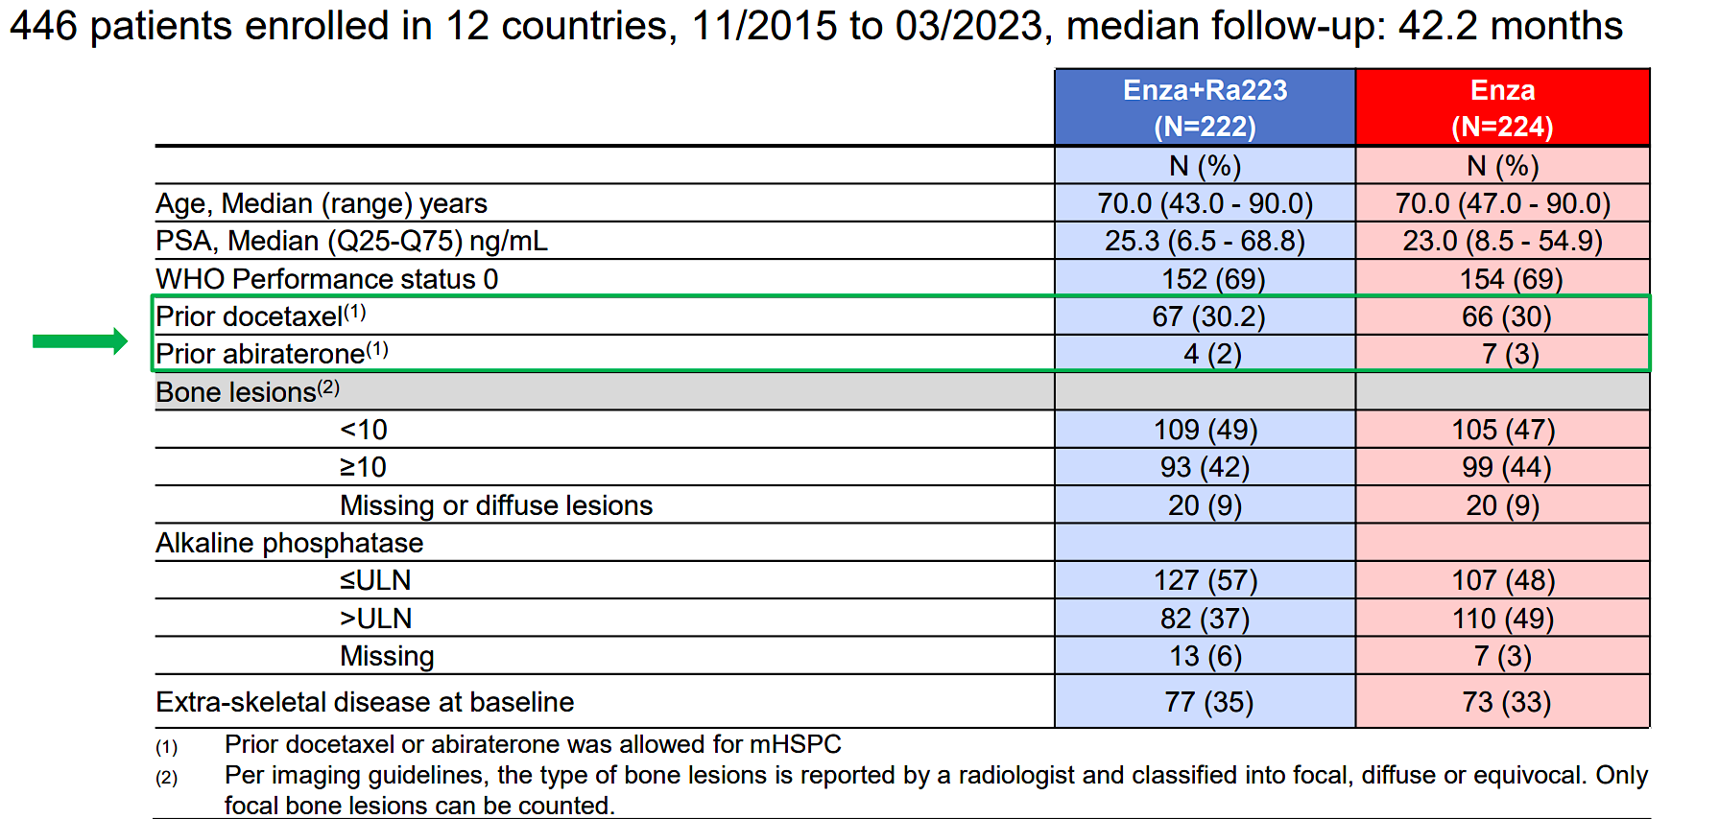
PEACE III Baseline Characteristics
Gillessen et al, ESMO, 2024

Slide 135
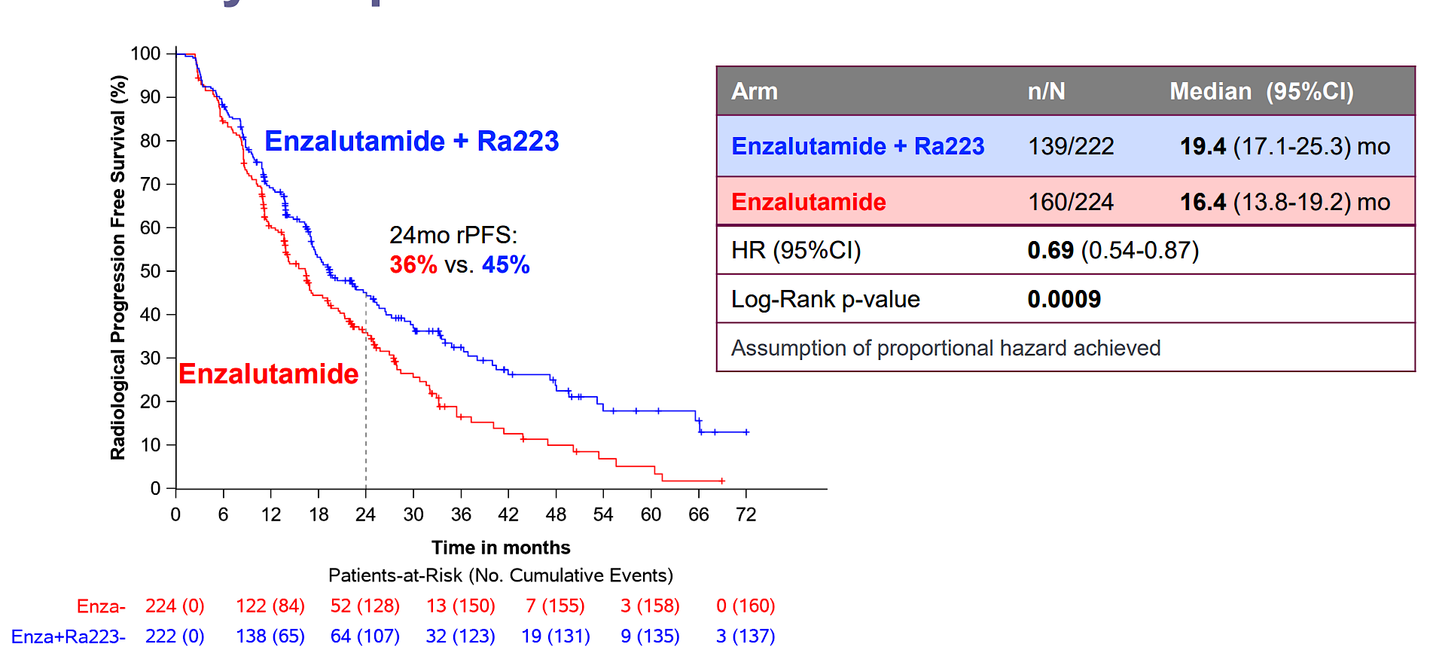
PEACE III Primary Endpoint rPFS
Gillessen et al, ESMO, 2024

Slide 136
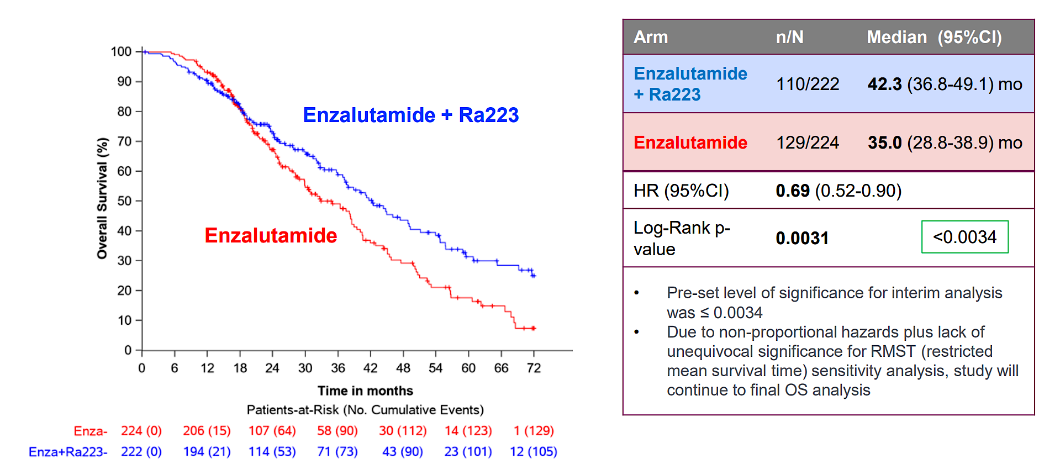
PEACE III Overall Survival
Gillessen et al, ESMO, 2024

Slide 137
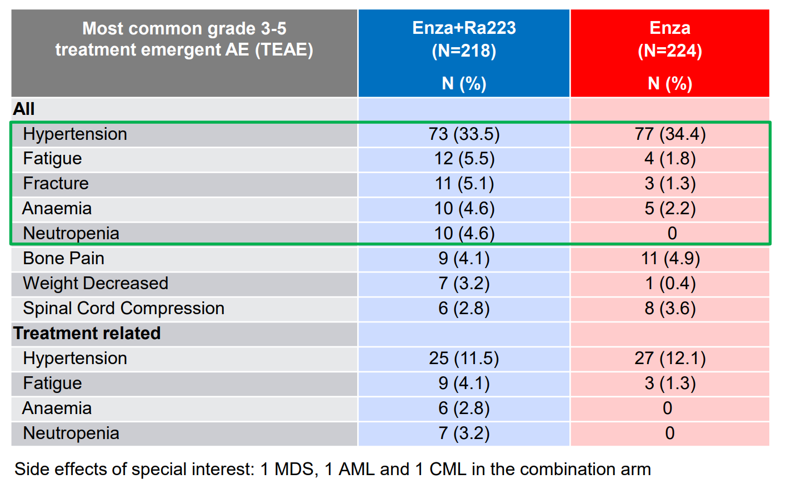
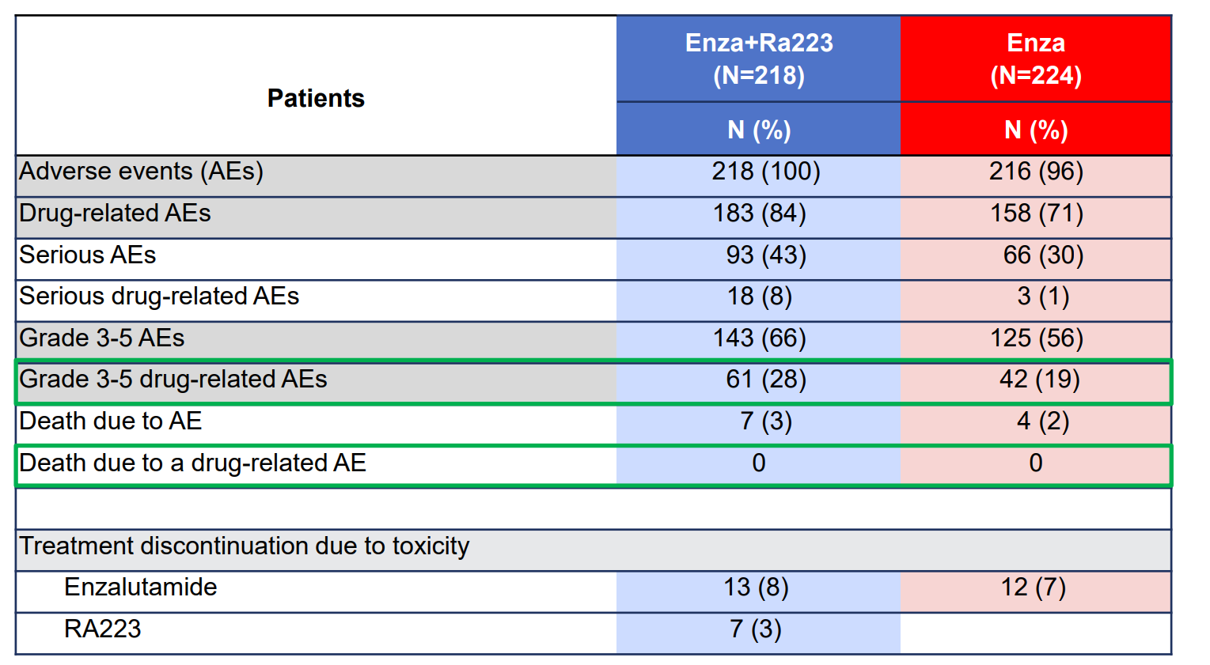
PEACE III Adverse Events
Gillessen et al, ESMO, 2024

Slide 138
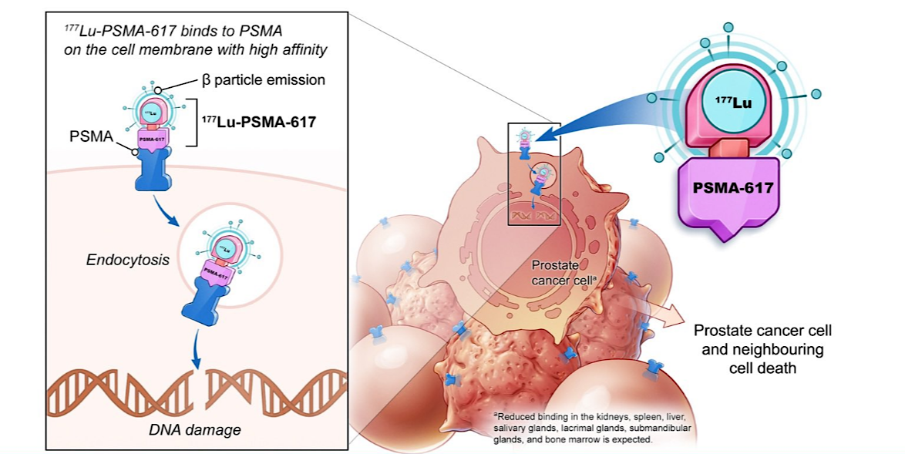
Mechanisms of Action of ¹⁷⁷Lu-PSMA-617
¹⁷⁷Lu-PSMA-617: β-emitting radioligand conjugated to PSMA-binding peptide
PSMA (prostate-specific membrane antigen): Cell surface receptor involved in folate uptake and cell migration, proliferation, survival
Overexpressed in ~80% of mCRPC
Also expressed in normal prostate, proximal renal tubules, small intestine, salivary glands

Slide 139
Phase III VISION: ¹⁷⁷Lu-PSMA-617 + SoC vs SoC
OS
 | ¹⁷⁷Lu-PSMA-617 + SoC (n = 551) | SoC (n = 280)
Median OS, mo | 15.3 | 11.3
HR (95% CI) | 0.62 (0.52-0.74; P <.001)
¹⁷⁷Lu-PSMA-617 7.4 GBq (200 mCi) Q6W x 4-6 cycles + Protocol-permitted SoC*
(n = 551)
100
Patients with PSMA+ mCRPC on PET/CT with ⁶⁸Ga-PSMA-11; ≥1 prior AR pathway inhibitor and prior ≥1 taxane; ECOG PS 0-2
(N = 831)
80
60
¹⁷⁷Lu-PSMA-617 + SOC
OS (%)
SoC
Protocol-permitted SoC*
(n = 280)
40
20
*Excludes CT, immunotherapy, systemic radioisotopes, and investigational drugs.
0
0
2
4
6
8
10
12
14
16
18
20
22
24
26
28
30
32
Mo Since Randomization
PSMA+ mCRPC defined as ≥1 PSMA+ metastatic lesion with ⁶⁸Ga uptake > liver and no PSMA- lesions in bone with soft tissue component ≥1 cm, lymph nodes ≥2.5 cm, or solid organ ≥1 cm
Of 1003 patients who underwent scanning for VISION, 12.6% did not meet PSMA+ criteria
Sartor et al. NEJM. 2021;385:1091.
Notes:
BICR, blinded independent central review; BSoC, best standard of care; DCR, disease control rate; ECOG, Eastern Cooperative Oncology Group; HRQoL, health-related quality of life; LDH, Lactate dehydrogenase; mCRPC, metastatic castration-resistant prostate cancer; mets, metastases; OS, overall survival; PCWG, prostate cancer working group; PS, performance status; PSA, prostate-specific antigen; PSMA, prostate-specific membrane antigen; RECIST, Response Evaluation Criteria in Solid Tumors.

Slide 140
VISION: Safety
Patients, n (%) | All Grades |  | Grade 3-5
 | ¹⁷⁷Lu-PSMA-617 + SoC (n = 529) | SoC Alone (n = 205) | ¹⁷⁷Lu-PSMA-617 + SoC (n = 529) | SoC Alone (n = 205)
Fatigue | 228 (43.1) | 47 (22.9) | 31 (5.9) | 3 (1.5)
Dry mouth | 205 (38.8) | 1 (0.5) | 0 | 0
Nausea | 187 (35.3) | 34 (16.6) | 7 (1.3) | 1 (0.5)
Anemia | 168 (31.8) | 27 (13.2) | 68 (12.9) | 10 (4.9)
Back pain | 124 (23.4) | 30 (14.6) | 17 (3.2) | 7 (3.4)
Arthralgia | 118 (22.3) | 26 (12.7) | 6 (1.1) | 1 (0.5)
Decreased appetite | 112 (21.2) | 30 (14.6) | 10 (1.9) | 1 (0.5)
Constipation | 107 (20.2) | 23 (11.2) | 6 (1.1) | 1 (0.5)
Diarrhea | 100 (18.9) | 6 (2.9) | 4 (0.8) | 1 (0.5)
Vomiting | 100 (18.9) | 13 (6.3) | 5 (0.9) | 1 (0.5)
Thrombocytopenia | 91 (17.2) | 9 (4.4) | 42 (7.9) | 2 (1.0)
Lymphopenia | 75 (14.2) | 8 (3.9) | 41 (7.8) | 1 (0.5)
Leukopenia | 66 (12.5) | 4 (2.0) | 13 (2.5) | 1 (0.5)
Sartor et al. NEJM. 2021;385:1091.
Notes:
SoC, standard of care.

Slide 141
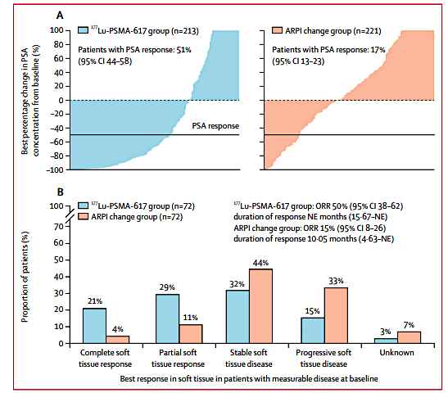
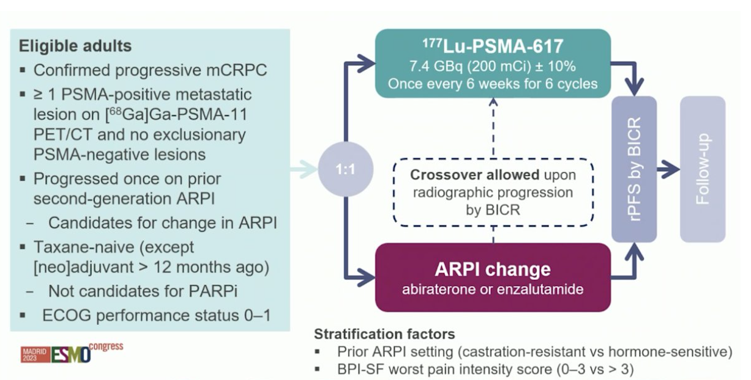
PSMAFore
Morris et al, Lancet, 2024

Slide 142
ENZA-P
Emmett et al, GU ASCO, 2025

Slide 143
ENZA-P
Emmett et al, GU ASCO, 2025

Slide 144
SPLASH Study Design
Sartor et al, ESMO, 2024

Slide 145
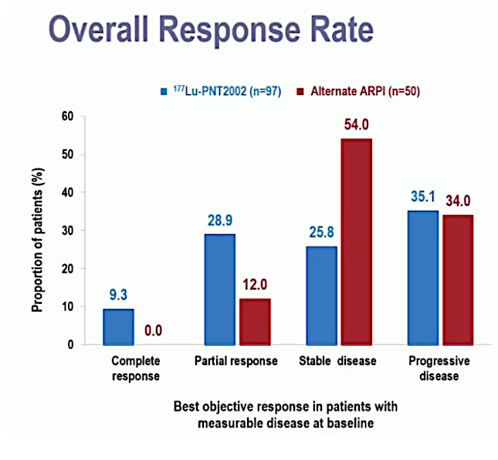
SPLASH – rPFS, ORR, PSA Response
PSA ≥50%: 35.7% vs. 14.6%
Sartor et al, ESMO, 2024

Slide 146
UpFrontPSMA
Azad et al, ESMO, 2024

Slide 147
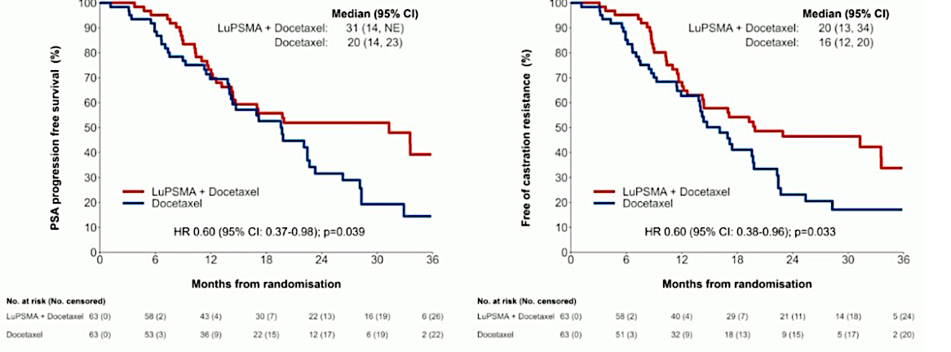
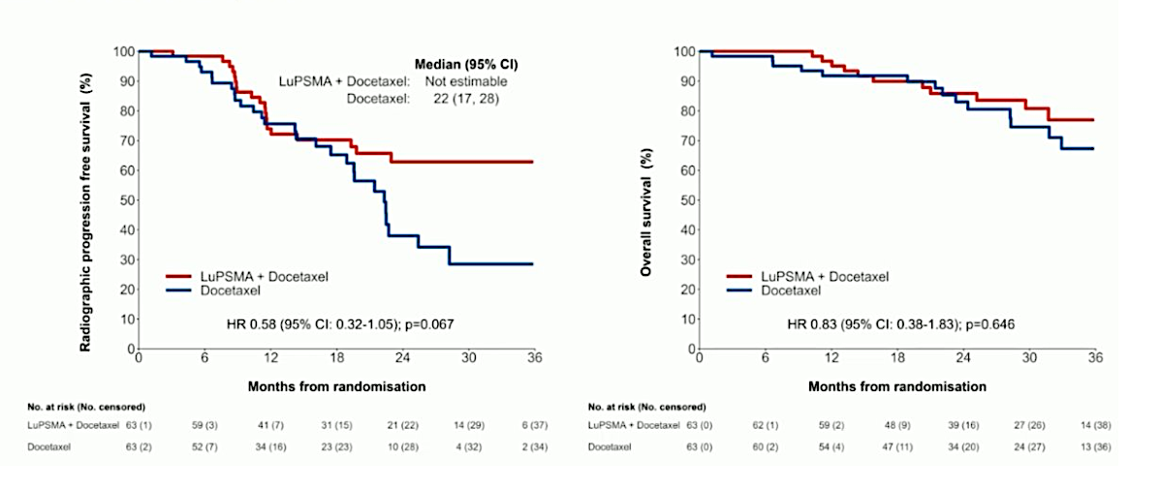
UpFrontPSMA
Azad et al, ESMO, 2024

Slide 148
Conclusions
Radium-223
First FDA-approved alpha-emitter (2013) with calcium-mimetic properties that specifically targets bone metastases, extending overall survival in the ALSYMPCA trial with a manageable safety profile, though effectiveness is limited to bone disease with minimal impact on PSA levels.
177Lu-PSMA-617
First PSMA-targeted radiopharmaceutical (approved 2022) that demonstrated significant survival benefits in the VISION trial, effectively targeting PSMA-expressing metastatic sites with robust PSA responses, which received FDA approval expansion in March 2025 for pre-chemotherapy use based on the PSMAfore trial
Future Directions
The field is rapidly evolving with numerous promising agents in development, including Actinium-225-PSMA (with higher energy alpha particles) and combination approaches

Slide 149
Faculty Case Presentations

Slide 150
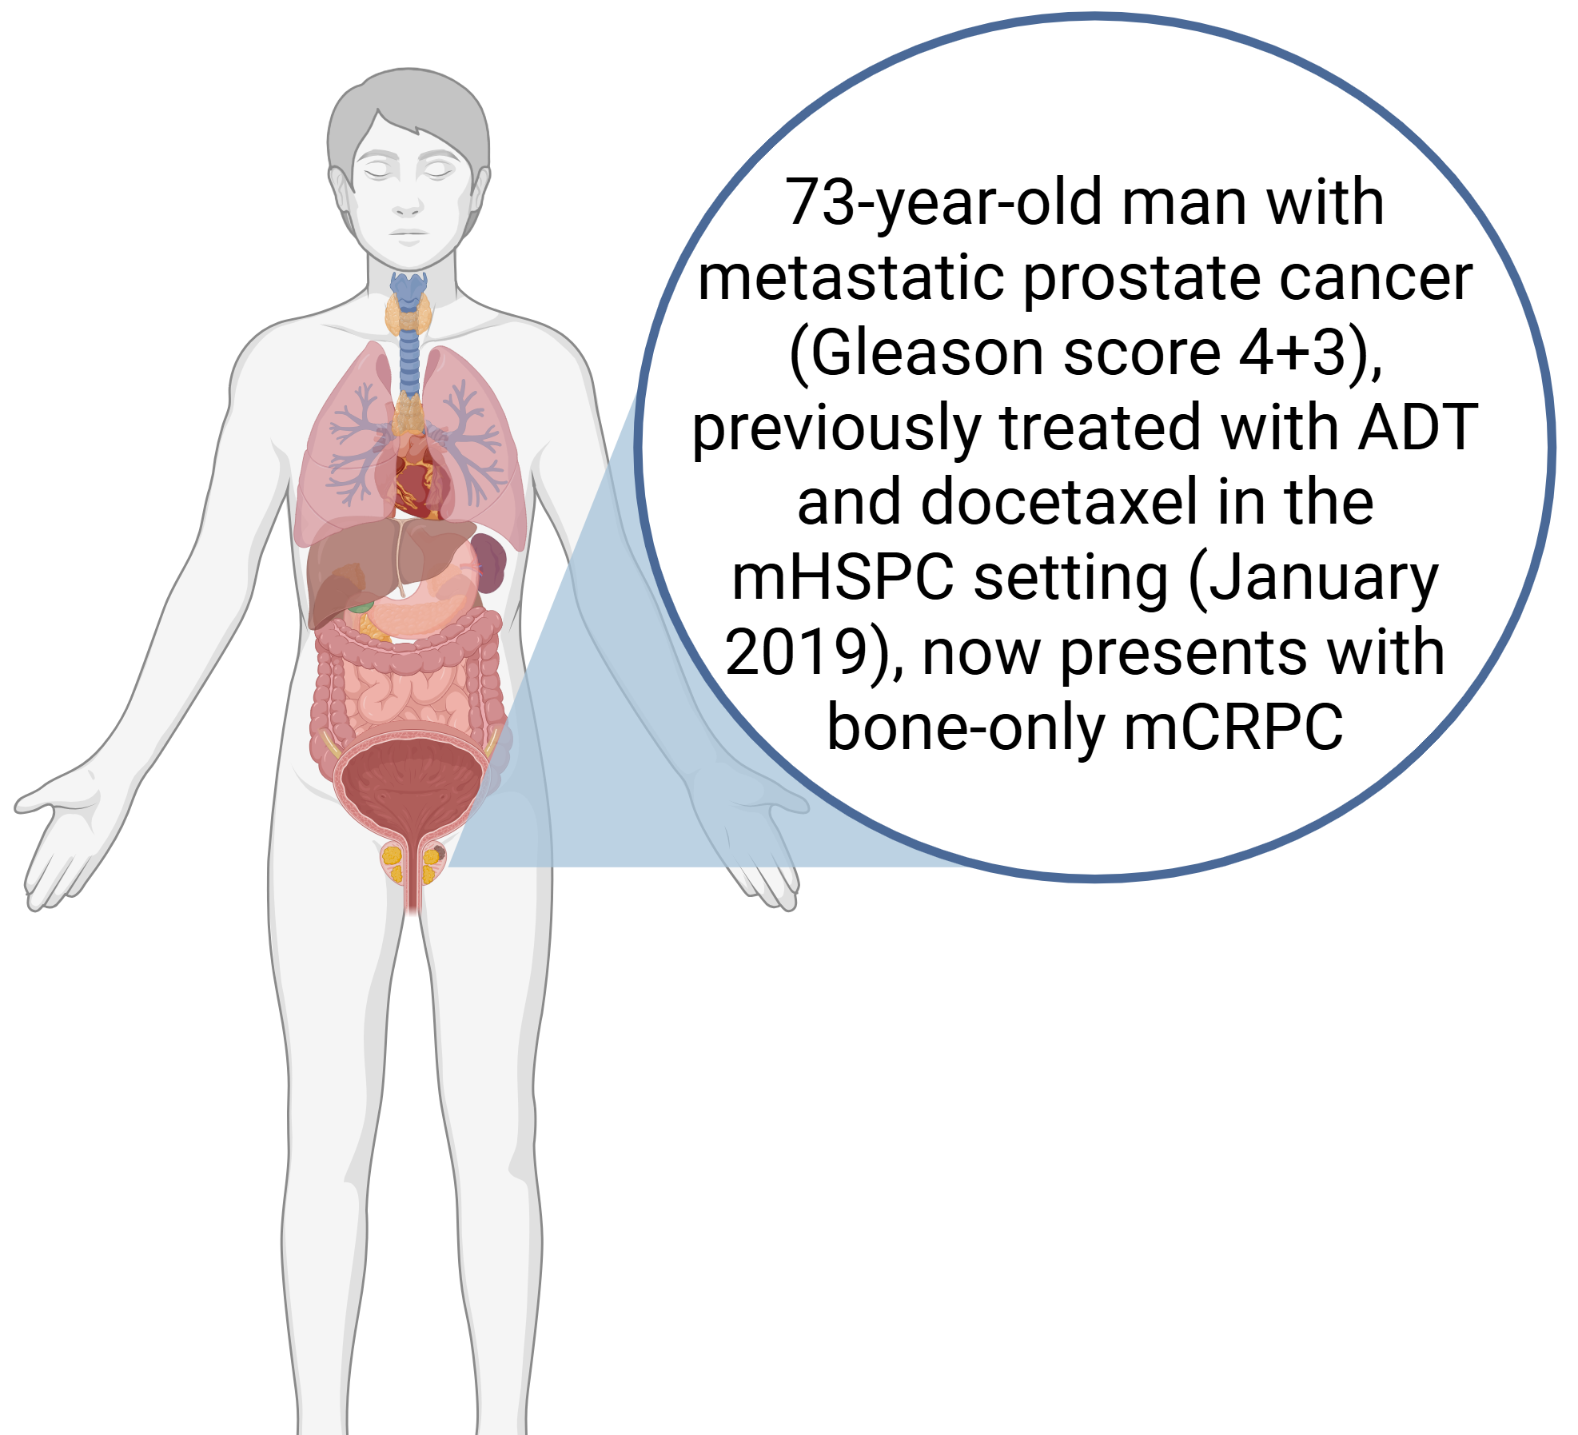
Case Presentation – Dr Agarwal: Enza + Radium-223 in mCRPC
May 2021
Bone scan showing multiple bone metastases

Slide 151
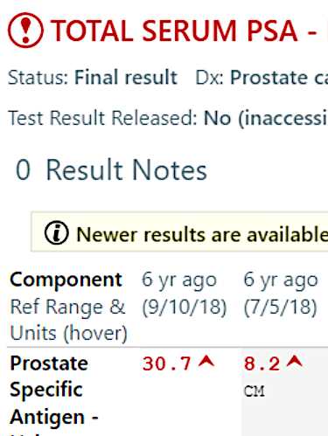
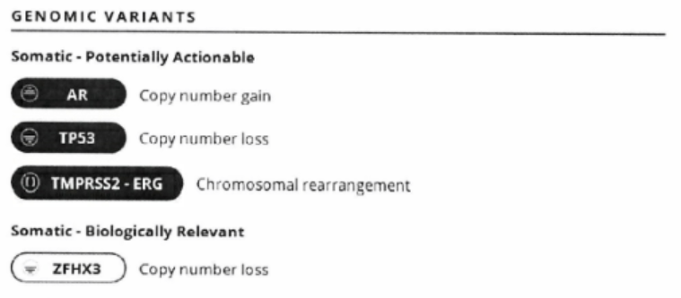
Case Presentation – Dr Agarwal: Enza + Radium-223 in mCRPC (cont’d)
May 2021
Onset of castration-resistant disease

Slide 152
Case Presentation – Dr Agarwal: Enza + Radium-223 in mCRPC (cont’d)
June 2021
Patient started on Enzalutamide + Radium-223
No fractures or skeletal-related events
Disease control for ~2 years
Zoledronic acid added to the regimen
Notes:
July 2021

Slide 153
QUESTIONS FOR THE FACULTY
Which patients with mCRPC do you feel are ideal candidates for radium-223?
What are the practical applications of the PEACE III trial for patients who have been exposed to AR pathway inhibitors in a prior line of therapy? Would you consider radium-223 in combination with enzalutamide in such a scenario? Would this depend at all on the specific AR pathway inhibitor the patient had received or how long ago they had received it?
How often do you see prolonged disease control with radium-223-based therapy as in this patient’s case?

Slide 154
Case Presentation – Dr Saad: 70-year-old patient
Treated with RoRx in 2018 for cT2 Gleason 4+3 prostate cancer
Recurrence: mHSPC in 6-2021 treated with ADT + APALUTAMIDE
Progression on APA with PSA 5.7 in 07-2023
PLUDO trial randomized to lutetium 09-2023
PSA post C1 3.76, C2 1.31, C3 0.29, C4 0.02
Last seen May 2025 PSA remains 0.02 ECOG 0
No radiographic progression

Slide 155
QUESTIONS FOR THE FACULTY
How are you currently employing lutetium Lu 177 vipivotide tetraxetan for patients with mCRPC vis-à-vis other evidence-based options? Given the recent expansion of its indication, in which situations are you prioritizing it over taxane-based chemotherapy?
What other novel radiopharmaceuticals do you believe may soon enter the treatment armamentarium for patients with PSMA-expressing mCRPC? If these therapies become available, how will you select between them and lutetium Lu 177 vipivotide tetraxetan?

Slide 156
Agenda
MODULE 1: Evolving Management of Nonmetastatic Hormone-Sensitive Prostate Cancer (HSPC) — Dr Saad
MODULE 2: Current Treatment for Metastatic HSPC — Dr Armstrong
MODULE 3: Role of PARP Inhibition in Metastatic Castration-Resistant Prostate Cancer (mCRPC) — Dr Agarwal
MODULE 4: Current and Future Use of Radiopharmaceuticals for mCRPC — Dr McKay
MODULE 5: Promising Novel Agents and Strategies Under Investigation for the Management of Prostate Cancer — Dr Beltran

Slide 157
Promising Novel Agents and Strategies Under Investigation for the Management of Prostate Cancer
Himisha Beltran, MD
Dana-Farber Cancer Institute
Boston, Massachusetts, United States

Slide 158
New therapies across the disease continuum
Localized prostate cancer: Phase III trial of CAN-2409+prodrug in combination with standard of care EBRT for newly diagnosed localized prostate cancer
De novo metastatic hormone sensitive prostate cancer: Phase III CAPItello-281 trial assessing capivasertib plus abiraterone/ADT in patients with PTEN deficiency
Metastatic CRPC: Early phase data supporting mevrometostat in combination with enzalutamide

Slide 159
CAN-2409
Locally delivered oncolytic therapy, results in vaccination against the injected tumor.
Consists of a non-replicating adenovirus engineered to deliver gene encoding Herpes virus thymidine kinase in tumor cells
Thymidine kinase converts oral valacyclovir into a phosphorylated nucleotide that is incorporated into the tumor cell’s genome → termination of DNA synthesis and cell death
Overall results in immunogenic cell death, release of tumor specific antigens recognized by immune system. Adenovirus itself recruits immune cells -> response in injected tumor + distant metastases

Slide 160
CAN-2409

Slide 161
Primary Endpoint

Slide 164
New therapies across the disease continuum
Localized prostate cancer: Phase III trial of CAN-2409+prodrug in combination with standard of care EBRT for newly diagnosed localized prostate cancer
De novo metastatic hormone sensitive prostate cancer: Phase III CAPItello-281 trial assessing capivasertib plus abiraterone/ADT in patients with PTEN deficiency
Metastatic CRPC: Early phase data supporting mevrometostat in combination with enzalutamide

Slide 165
In mHSPC, PI3K/AKT dysregulation by deficiency of PTEN
PTEN deficiency, through gene deletion and other mechanisms, leads to unopposed PI3K/AKT signalling, contributing to tumour growth and progression, and development of treatment resistance
PTEN is a protein that modulates PI3K/AKT signalling by opposing AKT activation^{2,4}
Insulin, growth factors or hormones
Alterations, such as PTEN rearrangements and deletions, are the predominant causes of PI3K/AKT pathway activation^{7,9}
Cell membrane receptor
Cell membrane
Spectrum of alterations in mHSPC¹⁰
PTEN is a key tumour suppressor, and deficiency leads to unregulated PI3K/AKT signalling, which can contribute to tumour growth and progression and development of treatment resistance^{1–6}
Cell cytoplasm
PI3K
PTEN
AKT
Deficiency of PTEN protein function or PTEN gene inactivation occurs in ~25% of patients with de novo mHSPC and is associated with poor outcomes^{2,4,7,8}
FOX01
mTOR
GSK3
Cell survival
Cell growth, protein synthesis
Cell proliferation
1. Hoxhaj G and Manning BD. Nat Rev Cancer 2020;20:74–88; 2. Jamaspishvili T, et al. Nat Rev Urol 2018;15:222–234; 3. Brown JS and Banerji U. Pharmacol Ther 2017;172:101–115; 4. Marques RB, et al. Eur Urol 2015;67:1177–1185; 5. Glaviano A, et al. Mol Cancer 2023;22:138; 6. Manning BD and Toker A. Cell 2017;169:381–405; 7. Ferraldeschi R, et al. Eur Urol. 2015;67:795–802; 8. AstraZeneca Data on File. CAPItello-281 Screening Data; 9. Phin S, et al. Front Oncol 2013;3:240; 10. Stopsack KH, et al. Clin Cancer Res 2020;26:3230–3238; 11. Pompura SL, Dominguez-Villar M. J Leukoc Biol 2018;103:1065–1076.

Slide 166
The AR and PI3K/AKT pathways are reciprocally cross-regulated, so that inhibition of one leads to upregulation of the other
Growth factors
Growth factors
AR pathway
T
PI3K/AKT pathway
Rationale for AKT and AR co-inhibition
Inhibition of the AR pathway activates the PI3K/AKT pathway by reducing levels of the AKT phosphatase PHLPP, therefore increasing activation of AKT and its downstream targets
T
Cell cytoplasm
AR signalling inhibition
RAS/RAF/ERK signalling
Conversely, treatment with a PI3K or AKT inhibitor results in increased levels of AR protein and increases AR target gene activity
PTEN
PI3K
AR transcription factor activity
PHLPP
AKT
AKT inhibition
AR
AR
Cell nucleus
AR targeted genes
mTOR
FKBP5
PHLPP
degradation
Differentiation and survival
Cell proliferation and prostate cancer progression through PI3K/AKT/PTEN-dependent signalling
Carver, et al. 2011 and Mulholland, et al. 2011
In PTEN-deficient prostate tumours, the PI3K/AKT and AR pathways cooperate to drive tumour progression

Slide 167
In mCRPC, co-inhibition of AR and AKT in patients with PTEN-deficient tumours
Ipatasertib + abiraterone significantly improved rPFS compared with placebo + abiraterone in patients with PTEN-deficient mCRPC. However, there was no statistically significant difference in the ITT population of the Phase III randomised IPATential150 trial
Co-primary endpoint: rPFS in the PTEN-deficient population (IHC ≥50%)
Co-primary endpoint: rPFS in the ITT population
Rationale for AKT and AR co-inhibition
 | Placebo + Abi n=261 | Ipatasertib + Abi n=260
Events, n (%) | 154 (59) | 124 (48)
rPFS at 1 year, % (95% CI) | 63.3 (57.3–69.3) | 64.4 (58.3–70.5)
 | Placebo + Abi n=554 | Ipatasertib + Abi n=547
Events, n (%) | 306 (55) | 252 (46)
PFS at 1 year, % (95% CI) | 63.0 (58.9–67.1) | 65.3 (61.1–69.5)
100
Stratified HR (95% CI)
0.77 (0.61–0.98)
p=0.034
100
Stratified HR (95% CI)
0.84 (0.71–0.99)
p=0.043
90
90
80
80
70
70
60
60
PFS (%)
PFS (%)
50
50
40
40
30
30
20
20
10
Median rPFS: 16.5 months
(95% CI: 13.9–17.0)
Median rPFS: 18.5 months
(95% CI: 16.3–22.1)
10
Median rPFS: 16.6 months
(95% CI: 15.6–19.1)
Median rPFS: 19.2 months
(95% CI: 16.5–22.3)
0
0
3
6
9
12
15
18
21
24
27
30
33
0
0
3
6
9
12
15
18
21
24
27
30
33
Number at risk
Months
Number at risk
Months
Pbo + Abi
Ipat + Abi
261
260
233
238
206
211
175
182
151
149
105
113
71
72
41
48
22
25
10
12
3
Pbo + Abi
Ipat + Abi
554
547
501
495
443
436
377
368
322
310
237
239
165
158
98
103
60
53
29
26
5
2
*PTEN loss by IHC was defined as ≥50% of the specimen’s tumour area having no detectable PTEN staining with VENTANA PTEN [SP218] assay
Sweeney C, et al. Lancet 2021;398(10295):131–142; 2. Clinicaltrials.gov. NCT03072238

Slide 168
CAPItello-281
Phase III randomised trial assessing the combination of capivasertib + abiraterone vs placebo + abiraterone in patients with PTEN-deficient de novo mHSPC
Capivasertib
400 mg po bid
(4 days on and 3 days off on a 28-day treatment cycle)
Key eligibility criteria:¹
mHSPC and PTEN-deficient tumours
Aged ≥18 years with asymptomatic or mildly symptomatic mHSPC
ECOG PS 0–1
Histologically confirmed de novo disease
Abiraterone
+ prednisone/ prednisolone
1000 mg po qd
(+ prednisone/prednisolone 5 mg qd)
Primary endpoint
rPFS
Secondary endpoints
OS
TFST
SSE-FS
TTPP
Time to PSA progression
TTCR
PFS2
PRO measures (BFI, BPI-SF, FACT-P)
ADT
Continued at given dose
Placebo
CAPItello-281
R
1:1
bid
(4 days on and 3 days off on a 28-day treatment cycle)
(N=~1000)
Stratification factors:
Volume of disease and visceral metastases (high volume with visceral metastases/high volume without visceral metastases/ low-volume disease)
Geographical region
Double-blind
Abiraterone
+ prednisone/ prednisolone
1000 mg qd
5 mg qd
ADT
Continued at given dose
ClinicalTrials.gov. NCT04493853

Slide 169
In CAPItello-281, the IHC cut-off for tumour PTEN deficiency was ≥90% (VENTANA assay)
This is equivalent to cytoplasmic PTEN staining in no more than 10% of viable malignant cells
An exploratory analysis of the IHC data in IPATential150 demonstrated that a 90% threshold resulted in an HR of 0.72 (95% CI: 0.53–0.97) and a median rPFS of 14.7 months vs 18.5 months, which further substantiates the clinical relevance for the selected population^{1–4}
IPATential150: rPFS by PTEN-deficient status by IHC % cut-off^{1,2}
PTEN loss | No. of patients |  | Median PFS |  | HR for progression or death (95% CI)
 |  |  | Placebo + abi | AKTi + abi
All pts | 1101 |  | 16.6 | 19.2 | 0.84 (0.71–1.00)
10% | 771 |  | 16.6 | 17.7 | 0.84 (0.69–1.02)
20% | 684 |  | 16.5 | 17.1 | 0.81 (0.66–0.99)
30% | 618 |  | 16.5 | 17.1 | 0.82 (0.66–1.02)
40% | 575 |  | 16.5 | 18.5 | 0.82 (0.65–1.03)
50% | 523 |  | 16.5 | 19.1 | 0.77 (0.61–0.98)
60% | 489 |  | 15.1 | 18.6 | 0.72 (0.56–0.92)
70% | 462 |  | 15.0 | 18.6 | 0.72 (0.56–0.93)
80% | 424 |  | 14.8 | 18.6 | 0.71 (0.54–0.92)
90% | 335 |  | 14.7 | 18.5 | 0.72 (0.53–0.97)
100% | 123 |  | 16.5 | 19.2 | 0.65 (0.39–1.08)
In IPATential150, PTEN deficiency by IHC was defined as ≥50% of the specimen’s tumour area having no detectable PTEN staining with VENTANA® antibody clone SP218¹
CAPItello-281
However, consistent rPFS benefits were observed when more stringent IHC cut-offs were used^{1,3}
AKTi + abi better
Pbo + abi better
*Tumour PTEN status was centrally assessed by IHC using a validated assay (VENTANA PTEN [SP218] assay; Ventana Medical Systems, Oro Valley, AZ, USA). This assay prospectively describes the PTEN status of PC baseline tumour samples (archival or newly collected).³ Abi, abiraterone; AKTi, protein kinase B inhibitor; ARPI, androgen receptor pathway inhibitor; CI, confidence interval; HR, hazard ratio; IHC, immunohistochemistry; Pbo, placebo; PC, prostate cancer; PTEN, phosphatase and tensin homologue; pts, patients; rPFS, radiographic progression-free survival. 1. de Bono J, et al. Presented at ASCO Genitourinary Cancers Symposium 2021; 2. Sweeney C, et al. Lancet 2021;398:131–142; 3. Sweeney C, et al. Article and supplementary online content. Lancet 2021;398:131–142; 4. CAPItello-281 Study Protocol.

Slide 170
Capivasertib
Press release, November 2024

Slide 171
New therapies across the disease continuum
Localized prostate cancer: Phase III trial of CAN-2409+prodrug in combination with standard of care EBRT for newly diagnosed localized prostate cancer
De novo metastatic hormone sensitive prostate cancer: Phase III CAPItello-281 trial assessing capivasertib plus abiraterone/ADT in patients with PTEN deficiency
Metastatic CRPC: Early phase data supporting mevrometostat in combination with enzalutamide

Slide 172
Targeting the epigenome in prostate cancer
PRC2
Mevrometostat
EZH2 (PRC2) Plays an Important Role in Lineage Specification
PRC2
Conteduca V et al, 2021; Parreno V et al. Nature 2024; Ku et al 2016

Slide 173
Epigenetic Dysregulation in CRPC/NEPC
Progression of prostate cancer
EZH2
Benign PCA CRPC NE
EZH2 target genes
Beltran H et al. Nat Med. 2016;22(3):298-305.

Slide 174
Beyond PRC2: Non-Canonical Function of EZH2
Xu K et al. Science. 2012;338(6113):1465-9. Davies A et al. Endocr Relat Cancer. 2020;27(2):R35-R50.

Slide 175
Mevrometostat + Enzalutamide Open-label, Dose Expansion Study
Study design
Mevrometostat 1250 mg orally BID empty stomach +
enzalutamide 160 mg orally QD (n=41)
Primary endpoints:
rPFS per investigator assessment
Safety
Patient population:
mCRPC
Prior AA
≤1 regimen of prior chemotherapy in any setting
Evidence of progression per modified PCWG3 criteria
Ongoing ADT
R
1:1
Secondary endpoints:
Objective responseª
PSA₅₀
Pharmacokinetics^{b}
Enzalutamide 160 mg orally QD (n=40)
N=81
Stratification factor:
Prior chemotherapy

Slide 176
Mevrometostat + Enzalutamide Open-label, Dose Expansion Study (cont)
Primary endpoint: rPFS by investigator
49% reduction in the risk of progression or death and ~8-month improvement in median rPFS
 | Mevrometostat 1250 mg BID empty stomach + enzalutamide (n=41) | Enzalutamide alone (n=40)
Events, n (%) | 15 (36.6) | 19 (47.5)
Median rPFS (95% CI), months | 14.3 (7.5, NE) | 6.2 (4.1, 13.9)
HR 0.51 (90% CI: 0.28, 0.95)
Median (IQR) duration of follow-up for rPFS was 9.6 (3.1-14.5) months.
Data cutoff: September 2, 2024.

Slide 177
Mevrometostat + Enzalutamide Open-label, Dose Expansion Study (cont)
ORR
Mevrometostat 1250 mg BID empty stomach + enzalutamide improved ORR vs enzalutamide
 | Mevrometostat 1250 mg BID empty stomach + enzalutamide (n=41)
Confirmed BOR, n (%)
PR | 4 (26.7)
SD | 11 (73.3)
PD | 0
ORR (CR + PR), % (95% CI) | 26.7 (7.8, 55.1)
 | Enzalutamide alone (n=14)ª
Confirmed BOR, n (%)
PR | 2 (14.3)
SD | 3 (21.4)
PD | 7 (50.0)
ORR (CR + PR), % (95% CI) | 14.3 (1.8, 42.8)

Slide 178
Mevrometostat AE Data
 | Mevrometostat 1250 mg BID empty stomach + enzalutamide (n=41) |  | Enzalutamide alone (n=40)
Event, n (%) | All grades | Grade ≥3 | All grades | Grade ≥3
Any TEAE | 40 (97.6) | 22 (53.7) | 37 (92.5) | 17 (42.5)
Treatment-related TEAE | 39 (95.1) | 20 (48.8) | 33 (82.5) | 9 (22.5)
Serious AE | 14 (34.1) | 13 (31.7) | 11 (27.5) | 10 (25.0)
Treatment-related serious TEAEª | 10 (24.4) | 10 (24.4) | 1 (2.5) | 1 (2.5)
TEAE leading to dose reduction | 15 (36.6) | 7 (17.1) | 3 (7.5) | 0
TEAE leading to study discontinuation | 1 (2.4) | 0 | 2 (5.0) | 1 (2.5)

Slide 179
Mevrometostat + Enzalutamide Open-label, Dose Expansion Study (cont)
Mevrometostat + enzalutamide was associated with a 49% reduction in risk of rPFS compared with enzalutamide
Mevrometostat 1250 mg BID on empty stomach + enzalutamide has a manageable safety profile
Plasma exposure with mevrometostat 875 mg with food was similar to 1250 mg empty stomach, with an improved safety profile
Mevrometostat 875 mg with food is the recommended phase 3 dose

Slide 180
Next steps Mevrometostat + Enzalutamide
MEVPRO-1: Phase 3 Study Mevrometostat + Enzalutamide vs Physician Choice (Docetaxel or Enzalutamide) in Patients With mCRPC Previously Treated With Abiraterone (rPFS)
MEVPRO-2 Phase 3 Study Mevrometostat + Enzalutamide vs Placebo + Enzalutamide in ARPI-Naive Patients With mCRPC (rPFS)

Slide 181
Exciting new therapies with new mechanisms of action in late-stage clinical development across the disease continuum
Phase III trial of CAN-2409+prodrug in combination with standard of care EBRT for newly diagnosed localized prostate cancer (ASCO 2025)
Phase III CAPItello-281 trial assessing capivasertib plus abiraterone/ADT in patients with mHSPC and PTEN deficiency
Promising early phase data supporting mevrometostat in combination with enzalutamide for mCRPC

Slide 182
Faculty Case Presentations

Slide 183
Case Presentation – Dr Armstrong: mHSPC, low volume disease
71 yo WM presented with back pain to the ER after a negative sports medicine physical, worse with activity, but still bothering him after 2 months at night
PSA found to be 71 (first ever), alkaline phosphatase 220 (high), newly elevated from last year’s wellness check. Never had PSA screening.
PSMA PET/CT shows 4 bone metastases in his L-spine (2) and ribs, L ilium, PSMA Avid (SUV 14-20) and uptake in his prostate, no LAD
Prostate biopsy confirms high grade GG5 disease in multiple cores, sent for Foundation CDX testing. Found to have PTEN loss and a TMPRSS2-ERG fusion, no HRD alterations, MSS, TMB 2.0 (low), PD-L1 negative
Starts on ADT/abiraterone and inquires if there are other approaches that could improve his survival
PMH significant for HTN and hyperlipidemia, well controlled. No heart disease and he is active but somewhat sedentary, retired. Married for 45 years, no family history of malignancy but does have 3 children

Slide 184
QUESTIONS FOR THE FACULTY
Should general medical oncologists in community-based practice be testing their patients with mHSPC for PTEN deficiency? If so, how would you recommend that they do so?
When will data from the CAPItello-281 study be available, and what would they need to demonstrate for you to enthusiastically employ capivasertib? For a patient with mHSPC and PTEN deficiency for whom you would normally recommend a triplet regimen based on clinical characteristics, how would you select between an AR pathway inhibitor/docetaxel/ADT and capivasertib/abiraterone/ADT if capivasertib becomes available?

Slide 185
Case Presentation – Dr McKay: mCRPC
Patient Profile:
65-year-old male
Initial diagnosis: De novo metastatic disease (January 2022)
Presenting PSA: 125.6 ng/mL
Biopsy: Gleason 4+5=9 (Grade Group 5) in 8/12 cores
Imaging: Multiple bone metastases (spine, pelvis, ribs) on bone scan
No visceral metastases
Clinical stage: cT3b N1 M1b
Genomic testing on prostate biopsy: TP53 mutation identified, no HRR alterations
Initial treatment for mHSPC:
ADT + abiraterone 1000mg daily + prednisone 5mg daily (Jan 2022-May 2024)
Initial PSA response: Declined to 0.2 ng/mL within 3 months
Maintained response for 28 months with castrate testosterone <20 ng/dL
Recent progression to mCRPC (May 2024):
Rising PSA to 4.7 ng/mL despite castrate testosterone
CT scan and bone scan: New bone lesions, no visceral disease
Considered first-line mCRPC with progression on abiraterone
No prior enzalutamide exposure
No prior chemotherapy exposure
Current status (June 2024):
PSA: 7.2 ng/mL (rising)
ECOG performance status: 1
Mild fatigue, intermittent bone pain well-controlled with NSAIDs
Laboratory: Hemoglobin 13.1 g/dL, WBC 5.8, platelets 245K, liver/renal function normal
PSMA PET/CT: Diffuse PSMA-avid bone metastases (SUVmax 14-38)
No hepatic metastases, no lymphadenopathy >1.5cm
Treatment Course
Enrolled on Mevpro-1 trial

Slide 186
QUESTIONS FOR THE FACULTY
If mevrometostat were to eventually reach the clinic, how do you see it being sequenced relative to currently available therapies for mCRPC? Based on what we know so far, in which patient populations do you think mevrometostat might be particularly advantageous?
What other potential therapeutic targets are you most excited about in prostate cancer?

Slide 187
Consensus or Controversy? Clinical Investigators Provide Perspectives on the Current and Future Care of Patients with Chronic Lymphocytic Leukemia
A CME-Accredited Virtual Event Held in Conjunction with the 2025 ASCO® Annual Meeting
Sunday​, June 1, 2025 7:00 AM – 8:00 AM CT (8:00 AM – 9:00 AM ET)
Faculty
Catherine C Coombs, MD
William G Wierda, MD, PhD
Moderator
Neil Love, MD

Slide 188
Thank you for joining us! Your feedback is very important to us. Please complete the survey currently up on the iPads for attendees in the room and on Zoom for those attending virtually. The survey will remain open up to 5 minutes after the meeting ends. How to Obtain CME Credit In-person attendees: Please refer to the program syllabus for the CME credit link or QR code. Online/Zoom attendees: The CME credit link is posted in the chat room.

