Slide 1
Cases from the Community: Investigators
Discuss Available Research Guiding the Care of
Patients with Ovarian and Endometrial Cancer
Sunday, June 1, 2025
7:00 PM – 9:00 PM CT (8:00 PM – 10:00 PM ET)
Faculty
Joyce F Liu, MD, MPH
David M O’Malley, MD
Ritu Salani, MD, MBA
Alessandro D Santin, MD
Moderator
Shannon N Westin, MD, MPH, FASCO, FACOG

Slide 2





Faculty
Joyce F Liu, MD, MPH
Associate Chief and Director of Clinical Research
Division of Gynecologic Oncology
Dana-Farber Cancer Institute
Boston, Massachusetts
Alessandro D Santin, MD
Professor
Department of Obstetrics and Gynecology
Co-Chief, Gynecologic Oncology
Yale University School of Medicine
New Haven, Connecticut
David M O’Malley, MD
Director and Professor
Division of Gynecologic Oncology in Obstetrics
and Gynecology
John G Boutselis Chair in Gynecologic Oncology
The Ohio State University and The James Comprehensive Cancer Center
Columbus, Ohio
Moderator
Shannon N Westin, MD, MPH, FASCO, FACOG
Professor
Medical Director, Gynecologic Oncology Center
Director, Early Drug Development
Department of Gynecologic Oncology and Reproductive Medicine
The University of Texas
MD Anderson Cancer Center
Houston, Texas
Ritu Salani, MD, MBA
Director, Division of Gynecologic Oncology
Professor, Department of Obstetrics and Gynecology
David Geffen School of Medicine at UCLA
Los Angeles, California

Slide 3
Dr Liu — Disclosures
Faculty
Consulting Agreements | Bristol Myers Squibb, GSK
Advisory Boards (Compensated) | AbbVie Inc, AstraZeneca Pharmaceuticals LP, Daiichi Sankyo Inc, Eisai Inc, Genentech, a member of the Roche Group, GSK, Loxo Oncology Inc, a wholly owned subsidiary of Eli Lilly & Company, Merck, Regeneron Pharmaceuticals Inc, Revolution Medicines, Zentalis Pharmaceuticals

Slide 4
Dr O’Malley — Disclosures
Faculty
Advisory Committees and Consulting Agreements (Personal Fees) | AbbVie Inc, AstraZeneca Pharmaceuticals LP, Corcept Therapeutics, Duality Biologics, Eisai Inc, GSK, ImmunoGen Inc, Merck, MSD, Novocure Inc, Regeneron Pharmaceuticals Inc, Seagen Inc, Sumitomo Dainippon Pharma Oncology Inc, Verastem Inc, Zentalis Pharmaceuticals
Contracted Research (Institution Received Funds for Research) | AbbVie Inc, Advaxis Inc, Agenus Inc, Alkermes, Aravive Inc, Arcus Biosciences, AstraZeneca Pharmaceuticals LP, BeiGene Ltd, Bristol Myers Squibb, Deciphera Pharmaceuticals Inc, Eisai Inc, EMD Serono Inc, Exelixis Inc, F Hoffmann-La Roche Ltd, Genentech, a member of the Roche Group, Genmab US Inc, GSK, ImmunoGen Inc, Incyte Corporation, Iovance Biotherapeutics, Karyopharm Therapeutics, Leap Therapeutics Inc, Merck, Mersana Therapeutics Inc, MSD, Novartis, Novocure Inc, OncoC4, OncoQuest Inc, Pfizer Inc, pharmaand GmbH, Predictive Oncology Inc, Prelude Therapeutics, Regeneron Pharmaceuticals Inc, Seagen Inc, Sumitomo Dainippon Pharma Oncology Inc, Sutro Biopharma, Tesaro, A GSK Company, Verastem Inc
Data and Safety Monitoring Boards/Committees | Frantz Viral Therapeutics
Nonrelevant Financial Relationships | GOG Foundation, Ludwig Institute for Cancer Research Ltd, National Cancer Institute, NRG Oncology, RTOG Foundation, SWOG

Slide 5
Dr Salani — Disclosures
Faculty
Advisory Committees | Daiichi Sankyo Inc, Eisai Inc, Genmab US Inc, GSK, Karyopharm Therapeutics, Merck, Pfizer Inc
Nonrelevant Financial Relationships | Elsevier, UpToDate

Slide 6
Dr Santin — Disclosures
Faculty
Advisory Committees | Daiichi Sankyo Inc, Eisai Inc, Gilead Sciences Inc, Merck, Pfizer Inc, R-Pharm US
Contracted Research | Boehringer Ingelheim Pharmaceuticals Inc, Genentech, a member of the Roche Group, Gilead Sciences Inc, Merck, R-Pharm US, Synthon, Tesaro, A GSK Company, Verastem Inc.

Slide 7
Dr Westin — Disclosures
Moderator
Consulting Agreements | AstraZeneca Pharmaceuticals LP, Bayer HealthCare Pharmaceuticals, Caris Life Sciences, Clovis Oncology, Corcept Therapeutics, Daiichi Sankyo Inc, Eisai Inc, EQRx, Genentech, a member of the Roche Group, Gilead Sciences Inc, GSK, Immunocore, ImmunoGen Inc, Incyte Corporation, Lilly, Loxo Oncology Inc, a wholly owned subsidiary of Eli Lilly & Company, Merck, Mereo BioPharma, Mersana Therapeutics Inc, NGM Biopharmaceuticals, Nuvectis Pharma Inc, Pfizer Inc, pharmaand GmbH, Seagen Inc, Verastem Inc, Vincerx Pharma, Zentalis Pharmaceuticals, ZielBio
Contracted Research (to Institution) | AstraZeneca Pharmaceuticals LP, Avenge Bio, Bayer HealthCare Pharmaceuticals, Bio-Path Holdings Inc, Clovis Oncology, Daiichi Sankyo Inc, Genentech, a member of the Roche Group, GSK, Jazz Pharmaceuticals Inc, Loxo Oncology Inc, a wholly owned subsidiary of Eli Lilly & Company, Mereo BioPharma, Novartis, Nuvectis Pharma Inc, Pfizer Inc, pharmaand GmbH, Zentalis Pharmaceuticals

Slide 8
Dr Love — Disclosures
Dr Love is president and CEO of Research To Practice. Research To Practice receives funds in the form of educational grants to develop CME activities from the following companies: Aadi Bioscience, AbbVie Inc, ADC Therapeutics, Alexion Pharmaceuticals, Amgen Inc, Array BioPharma Inc, a subsidiary of Pfizer Inc, Arvinas, Astellas, AstraZeneca Pharmaceuticals LP, Aveo Pharmaceuticals, Bayer HealthCare Pharmaceuticals, BeiGene Ltd, Black Diamond Therapeutics Inc, Blueprint Medicines, Boehringer Ingelheim Pharmaceuticals Inc, Bristol Myers Squibb, Clovis Oncology, Coherus BioSciences, CTI BioPharma, a Sobi Company, Daiichi Sankyo Inc, Eisai Inc, Elevation Oncology Inc, Exact Sciences Corporation, Exelixis Inc, Genentech, a member of the Roche Group, Genmab US Inc, Geron Corporation, Gilead Sciences Inc, GSK, Hologic Inc, ImmunoGen Inc, Incyte Corporation, Ipsen Biopharmaceuticals Inc, Jazz Pharmaceuticals Inc, Johnson & Johnson, Karyopharm Therapeutics, Kite, A Gilead Company, Kura Oncology, Legend Biotech, Lilly, MEI Pharma Inc, Merck, Mersana Therapeutics Inc, Mirati Therapeutics Inc, Mural Oncology Inc, Natera Inc, Novartis, Novartis Pharmaceuticals Corporation on behalf of Advanced Accelerator Applications, Novocure Inc, Nuvalent, Pfizer Inc, Pharmacyclics LLC, an AbbVie Company, Puma Biotechnology Inc, Regeneron Pharmaceuticals Inc, Rigel Pharmaceuticals Inc, R-Pharm US, Sanofi, Seagen Inc, Servier Pharmaceuticals LLC, SpringWorks Therapeutics Inc, Stemline Therapeutics Inc, Syndax Pharmaceuticals, Taiho Oncology Inc, Takeda Pharmaceuticals USA Inc, TerSera Therapeutics LLC, and Tesaro, A GSK Company.

Slide 9
Commercial Support
This activity is supported by educational grants from AstraZeneca Pharmaceuticals LP, Daiichi Sankyo Inc, Eisai Inc, Karyopharm Therapeutics, Merck, and Mural Oncology Inc.
Research To Practice CME Planning Committee Members,
Staff and Reviewers
Planners, scientific staff and independent reviewers for Research To Practice have no relevant conflicts of interest to disclose.

Slide 10
This educational activity contains discussion of
non-FDA-approved uses of agents and regimens. Please refer to official prescribing information for each product for approved indications.

Slide 11
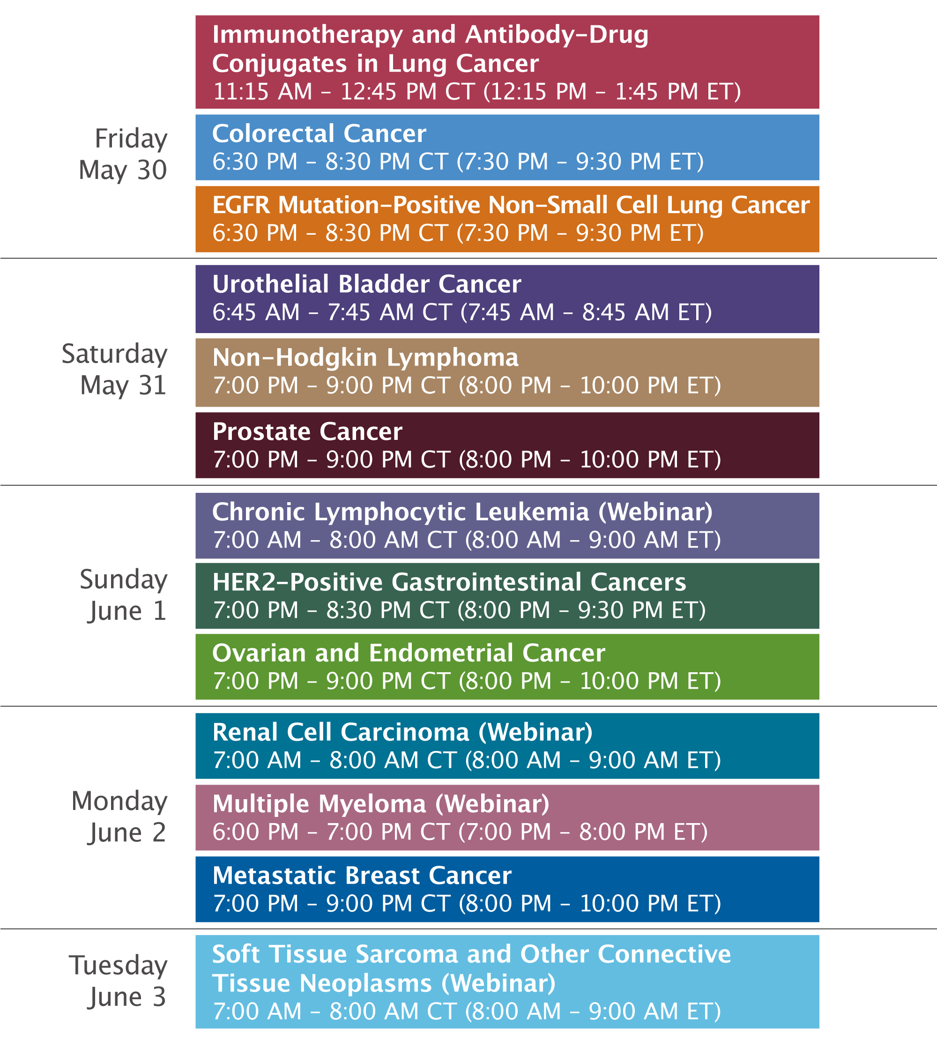

Slide 12



Clinicians in the Meeting Room
Networked iPads are available.
Review Program Slides: Tap the Program Slides button to review speaker presentations and other program content.
Answer Survey Questions: Complete the pre- and postmeeting surveys.
Ask a Question: Tap Ask a Question to submit a challenging case or question for discussion. We will aim to address as many questions as possible during the program.
For assistance, please raise your hand. Devices will be collected at the conclusion of the activity.
Notes:
12

Slide 13

Clinicians Attending via Zoom
Review Program Slides: A link to the program slides will be posted in the chat room at the start of the program.
Answer Survey Questions: Complete the pre- and postmeeting surveys.
Ask a Question: Submit a challenging case or question for discussion using the Zoom chat room.
Get CME Credit: A CME credit link will be provided in the chat room at the conclusion of the program.
Notes:
13

Slide 14
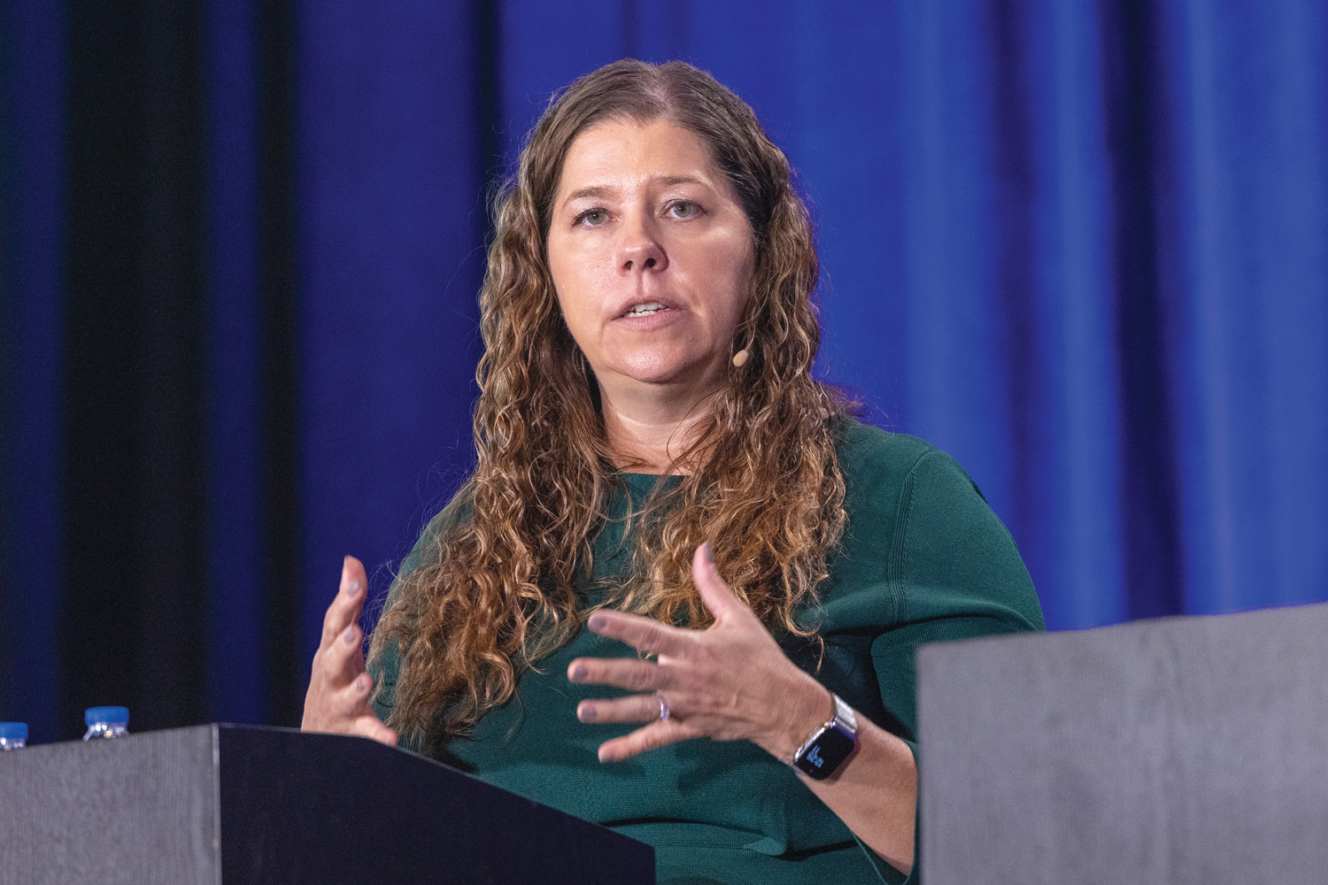
About the Enduring Program
The live meeting is being video
and audio recorded.
The proceedings from today will
be edited and developed into
an enduring web-based program.
An email will be sent to all attendees
when the activity is available.
To learn more about our education programs, visit our website, www.ResearchToPractice.com
Notes:
14
14

Slide 15
Cases from the Community: Investigators
Discuss Available Research Guiding the Care of
Patients with Ovarian and Endometrial Cancer
Sunday, June 1, 2025
7:00 PM – 9:00 PM CT (8:00 PM – 10:00 PM ET)
Faculty
Joyce F Liu, MD, MPH
David M O’Malley, MD
Ritu Salani, MD, MBA
Alessandro D Santin, MD
Moderator
Shannon N Westin, MD, MPH, FASCO, FACOG

Slide 16


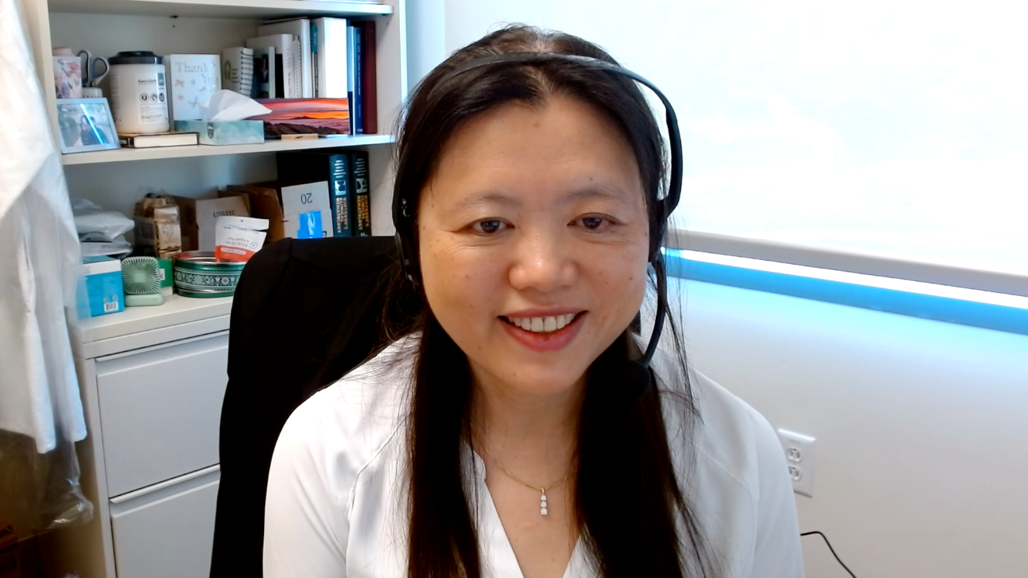
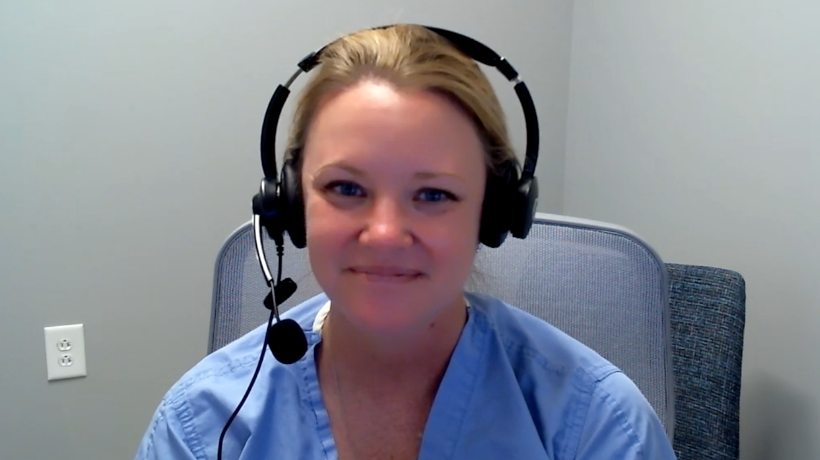

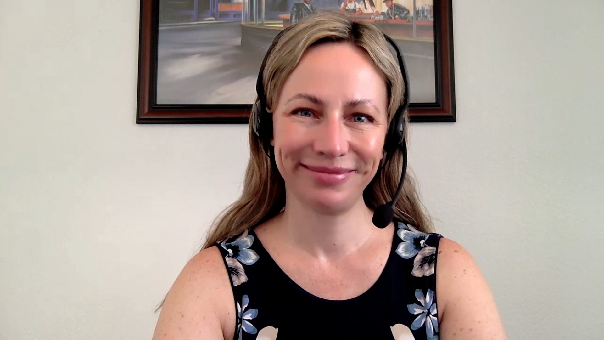
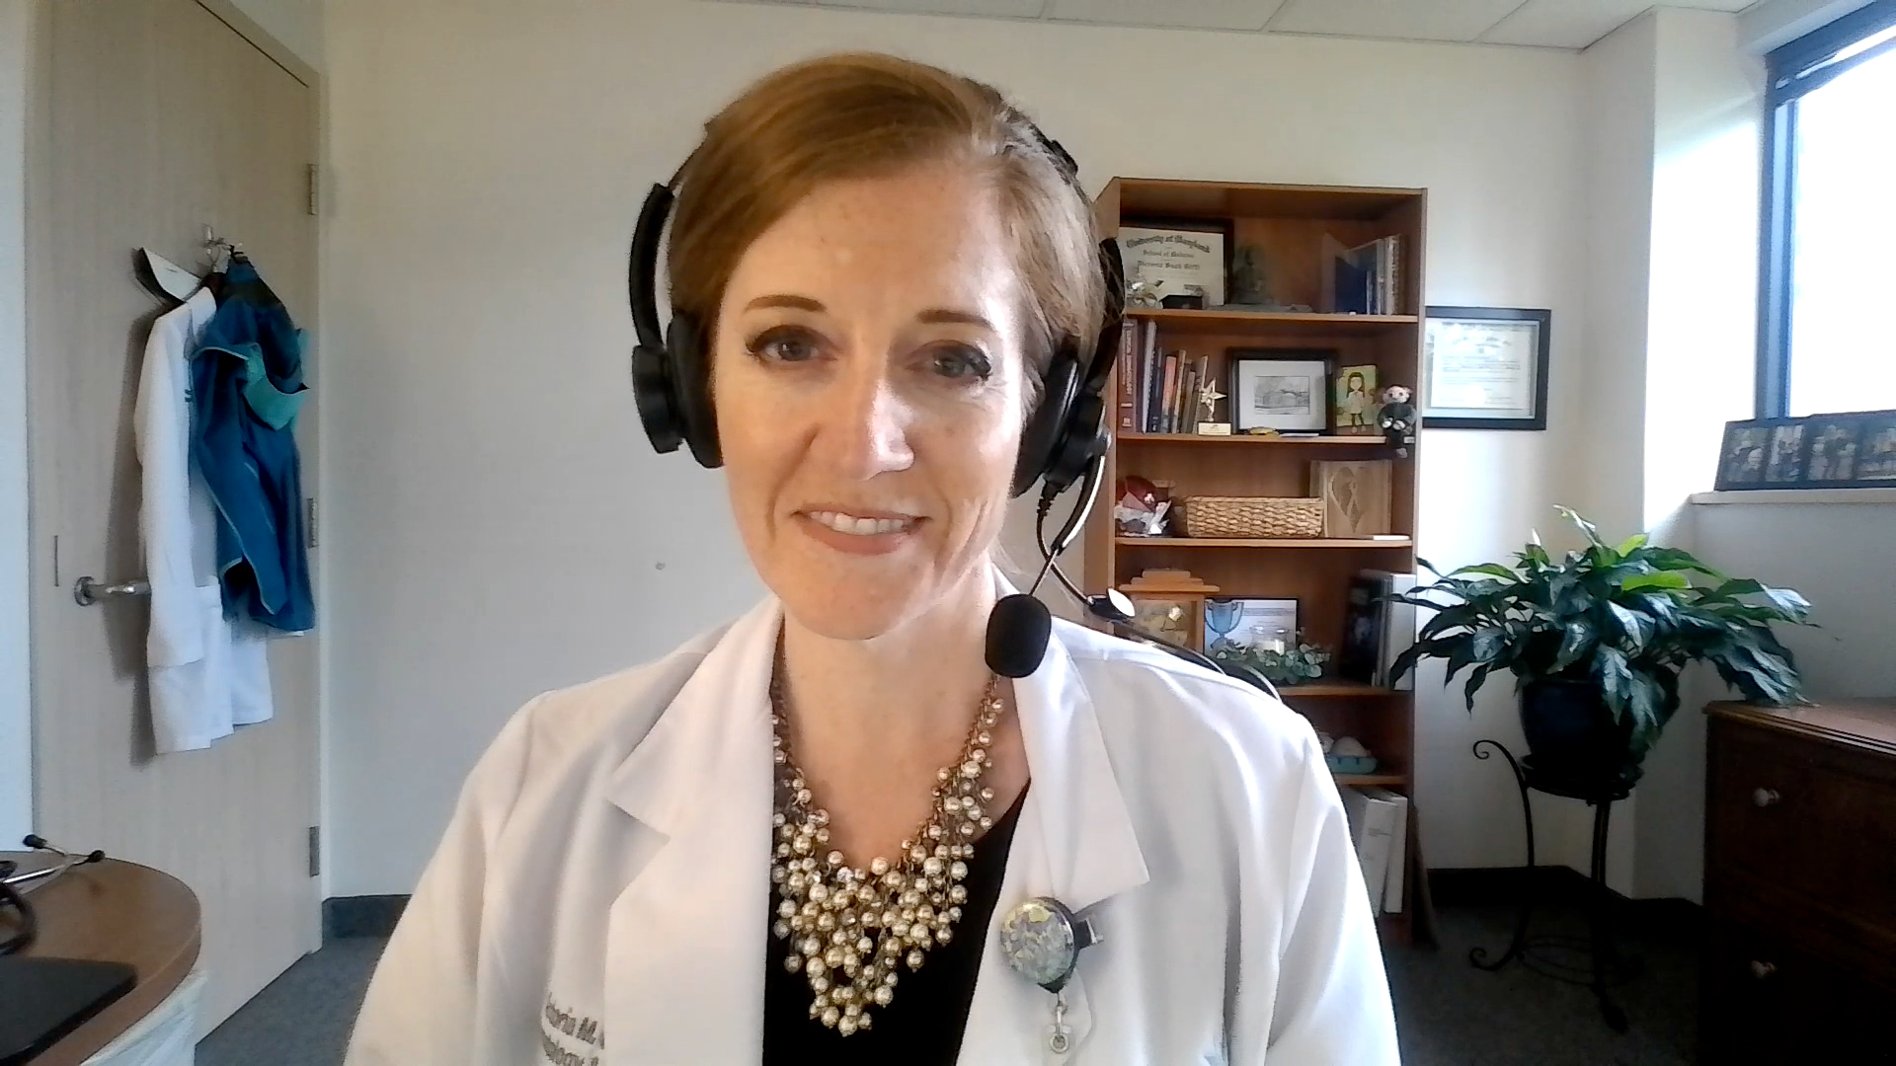
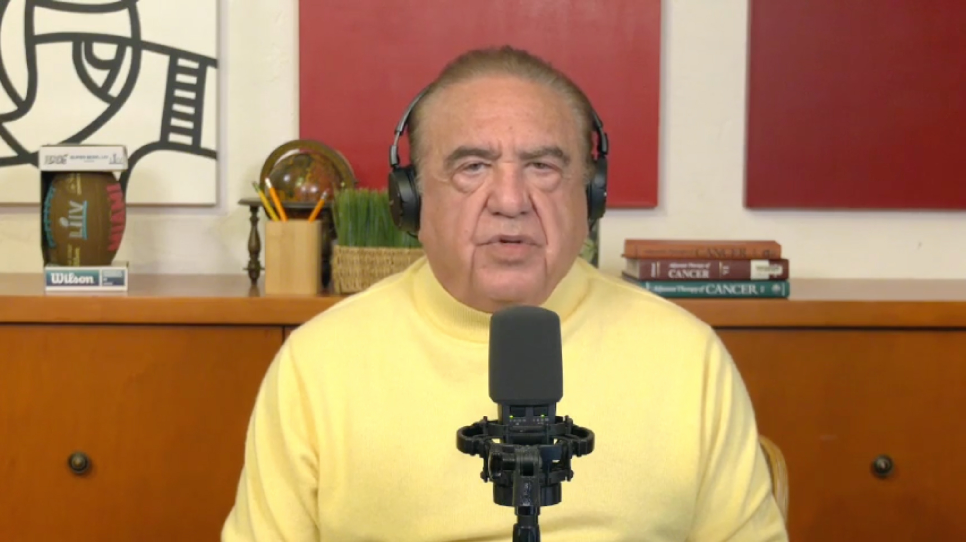
Contributing General Medical Oncologists
Spencer H Bachow, MD
Lynn Cancer Institute
Boca Raton, Florida
Erik Rupard, MD
Penn State Cancer Institute
Hershey, Pennsylvania
Gigi Chen, MD
John Muir Health
Walnut Creek, California
Kellie E Schneider, MD
Novant Health Cancer Institute
Charlotte, North Carolina
Karim ElSahwi, MD
Hackensack Meridian Health
Neptune City, New Jersey
Lyndsay J Willmott, MD
Virginia G Piper Cancer Care Network
Phoenix, Arizona
Victoria Giffi, MD
Meritus Hematology and Oncology Specialists
Hagerstown, Maryland
Neil Love, MD
Research To Practice
Miami, Florida

Slide 17
Agenda
MODULE 1: Up-Front Treatment for Advanced Ovarian Cancer (OC) — Dr Liu
MODULE 2: Current Management of Relapsed/Refractory (R/R) OC; Promising Novel Agents and Strategies Under Investigation — Dr O’Malley
MODULE 3: Role of HER2-Targeted Therapy in Advanced OC, Endometrial Cancer (EC) and Other Gynecologic Cancers — Dr Santin
MODULE 4: First-Line Therapy for Advanced EC — Dr Westin
MODULE 5: Current Therapeutic Options for R/R EC; Novel Investigational Strategies for Newly Diagnosed and Recurrent Disease — Dr Salani

Slide 18
Agenda
MODULE 1: Up-Front Treatment for Advanced Ovarian Cancer (OC) — Dr Liu
MODULE 2: Current Management of Relapsed/Refractory (R/R) OC; Promising Novel Agents and Strategies Under Investigation — Dr O’Malley
MODULE 3: Role of HER2-Targeted Therapy in Advanced OC, Endometrial Cancer (EC) and Other Gynecologic Cancers — Dr Santin
MODULE 4: First-Line Therapy for Advanced EC — Dr Westin
MODULE 5: Current Therapeutic Options for R/R EC; Novel Investigational Strategies for Newly Diagnosed and Recurrent Disease — Dr Salani

Slide 19
Upfront Treatment for Advanced Ovarian Cancer
Joyce Liu, MD, MPH
Associate Chief and Director of Clinical Research
Division of Gynecologic Oncology
Dana-Farber Cancer Institute, Boston, MA

Slide 20
Agenda
Biomarker testing in newly diagnosed ovarian cancer
PARP inhibitors as 1L maintenance for ovarian cancer
PARP inhibitors + IO therapy in 1L ovarian cancer maintenance
Future considerations

Slide 21
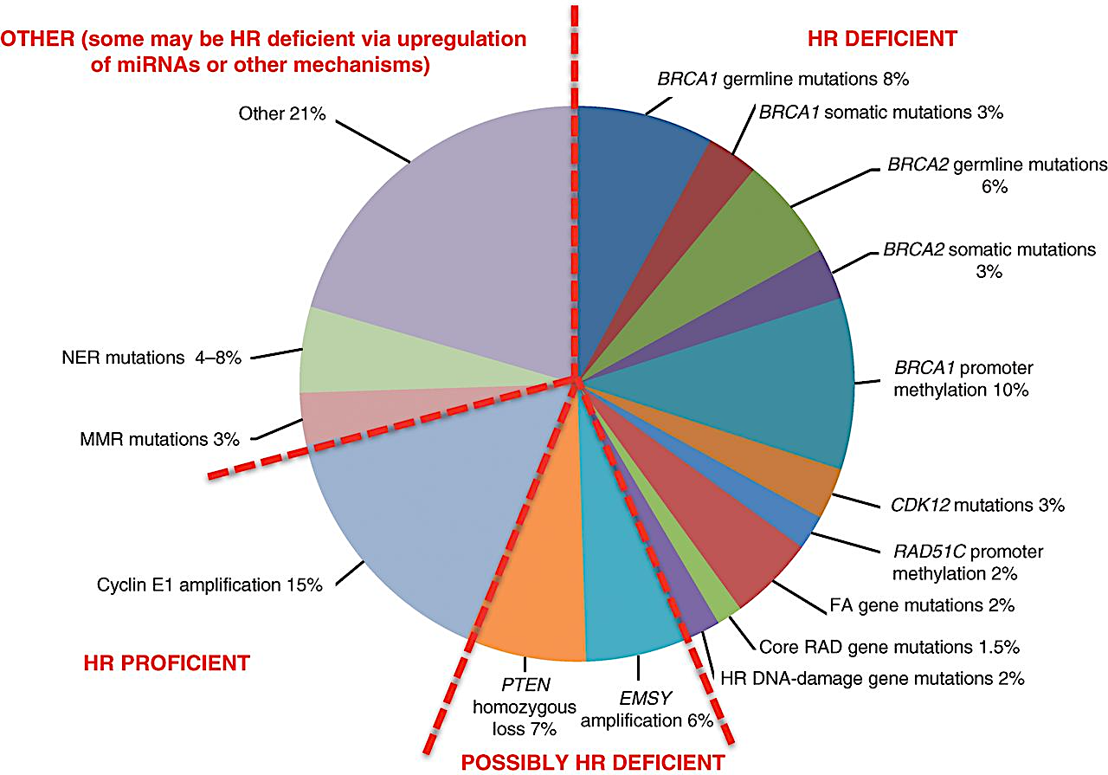
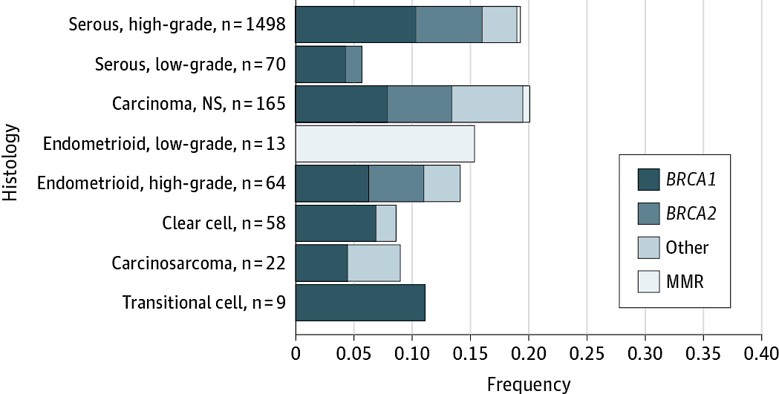
BRCA mutations and HRD are common in ovarian cancer
BRCA1/2 mutations occur across EOC subtypes
~50% of HGSOC have evidence of HR deficiency
Norquist et al, JAMA Oncol, 2016
Konstantinopoulos et al, Cancer Discov, 2015

Slide 22
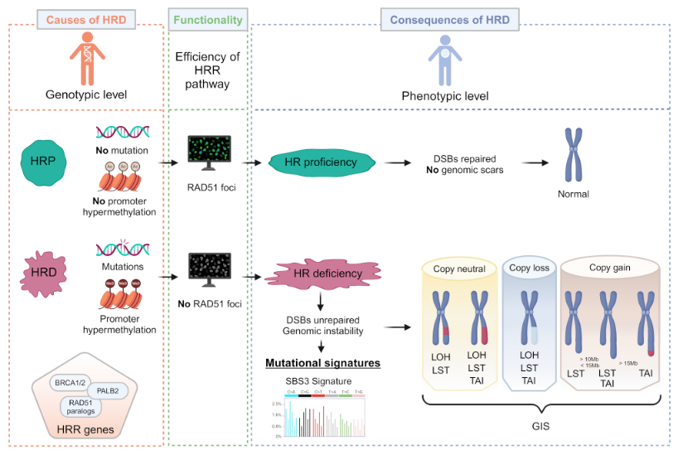
Testing for Homologous Recombination Deficiency (HRD)
Witz et al, Biomarker Research, 2025

Slide 23
Randomized studies informing front-line PARPi maintenance
BRCAm
BRCA wt; HRD test pos
BRCA wt; HRD test neg
SOLO-1 | Olaparib
PARPi monotherapy
PRIMA | Niraparib
PRIMA | Niraparib
PRIMA | Niraparib
ATHENA-MONO | Rucaparib
ATHENA-MONO | Rucaparib
ATHENA-MONO | Rucaparib
PARPi + bevacizumab
PAOLA-1 | Olaparib + bevacizumab
PAOLA-1 | Olaparib + bevacizumab
PAOLA-1 | Olaparib + bevacizumab
ATHENA-COMBO | Rucaparib + nivolumab
ATHENA-COMBO | Rucaparib + nivolumab
ATHENA-COMBO | Rucaparib + nivolumab
DUO-O | Olaparib + bevacizumab + durvalumab
DUO-O | Olaparib + bevacizumab + durvalumab
PARPi + IO
KEYLYNK-001 | Olaparib + pembrolizumab +/- bevacizumab
KEYLYNK-001 | Olaparib + pembrolizumab +/- bevacizumab

Slide 24
Randomized studies informing front-line PARPi maintenance
BRCAm
BRCA wt; HRD test pos
BRCA wt; HRD test neg
SOLO-1 | Olaparib
PARPi monotherapy
PRIMA | Niraparib
PRIMA | Niraparib
PRIMA | Niraparib
ATHENA-MONO | Rucaparib
ATHENA-MONO | Rucaparib
ATHENA-MONO | Rucaparib
PARPi + bevacizumab
PAOLA-1 | Olaparib + bevacizumab
PAOLA-1 | Olaparib + bevacizumab
PAOLA-1 | Olaparib + bevacizumab
ATHENA-COMBO | Rucaparib + nivolumab
ATHENA-COMBO | Rucaparib + nivolumab
ATHENA-COMBO | Rucaparib + nivolumab
DUO-O | Olaparib + bevacizumab + durvalumab
DUO-O | Olaparib + bevacizumab + durvalumab
PARPi + IO
KEYLYNK-001 | Olaparib + pembrolizumab +/- bevacizumab
KEYLYNK-001 | Olaparib + pembrolizumab +/- bevacizumab

Slide 25
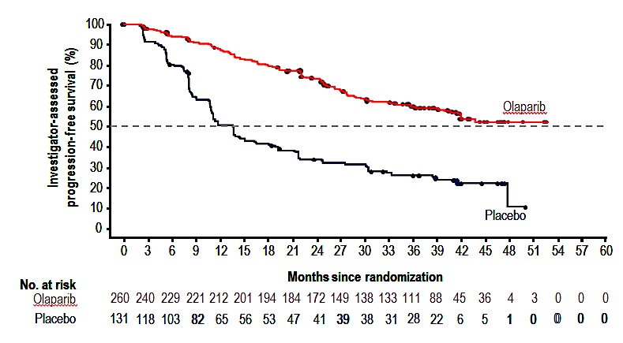
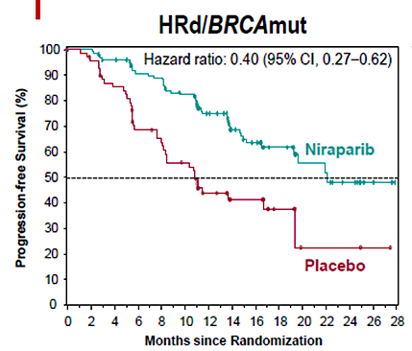
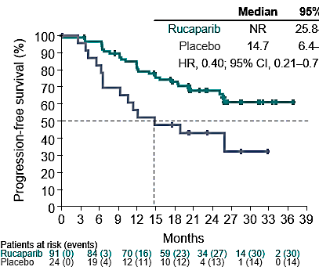
BRCAm tumors: PARP inhibitor monotherapy maintenance
SOLO-1
Olaparib
PRIMA
Niraparib
ATHENA-MONO
Rucaparib
N = 391 | N = 223 | N = 235
HR 0.30 95% CI 0.23-0.41 | HR 0.40 95% CI 0.27-0.62 | HR 0.40 95% CI 0.21-0.75
13.8 mos vs NR | 10.9 vs 22.1 mos | 14.7 mos vs NR
Moore N Engl J Med 2018; Gonzalez-Martin N Engl J Med 2019; Monk J Clin Oncol 2022

Slide 26
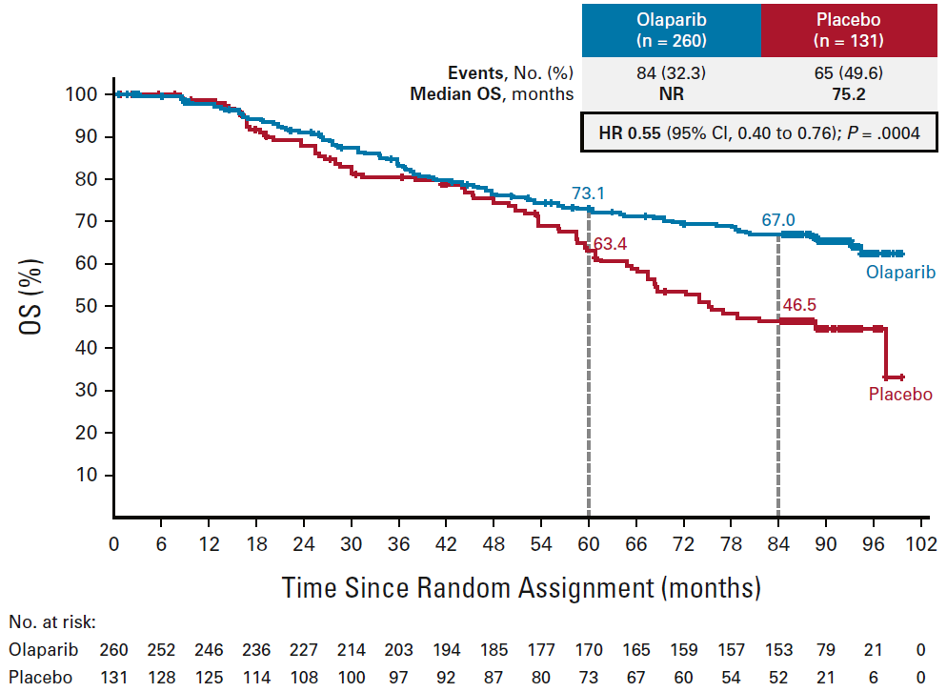
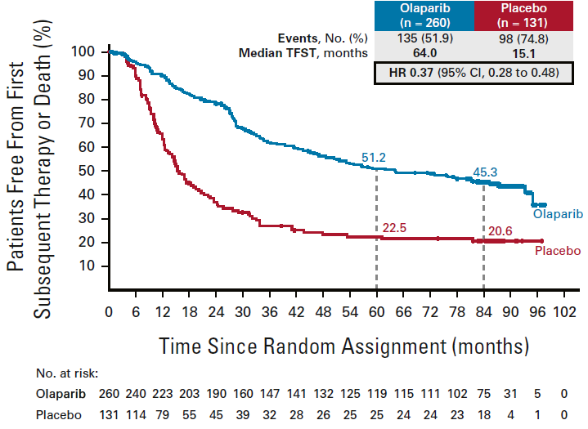
Olaparib maintenance demonstrates long-term benefit in individuals with BRCAm ovarian cancers
SOLO1: 7 year follow-up
Overall Survival
Time to First Subsequent Therapy
Median OS
75.2 vs NR
HR=0.55
Disilvestro et al., J Clin Oncol 2022

Slide 27
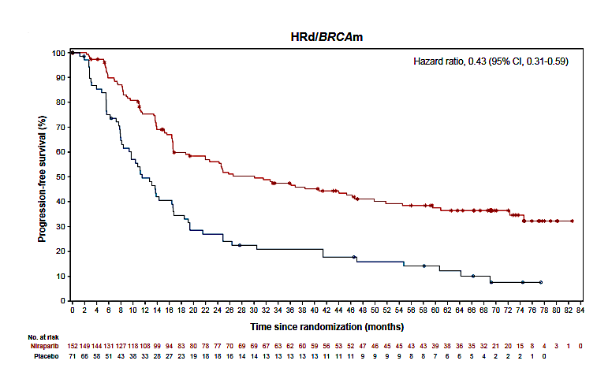
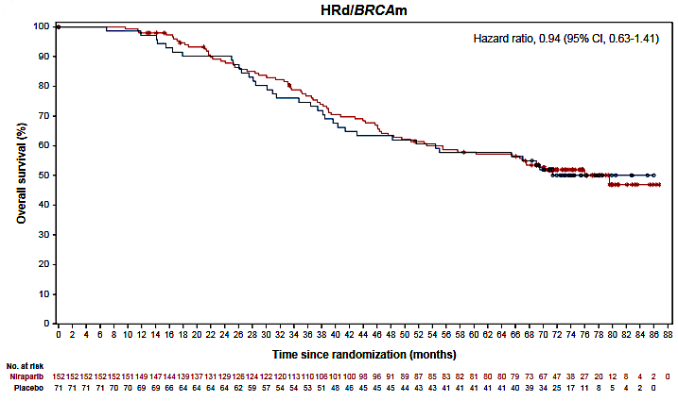
Niraparib maintenance demonstrates continued PFS benefit but no OS benefit in BRCAm ovarian cancers in final analysis
PRIMA Final OS Analysis: ~6.2 year follow-up
PFS HRD/BRCAm
OS HRD/BRCAm
Median PFS
11.5 vs 30.1 mos
HR 0.43
HR 0.94
(95% CI 0.63-1.41)
Gonzalez-Martin, 2024 ESMO Congress; Monk et al., Ann Oncol 2024

Slide 28
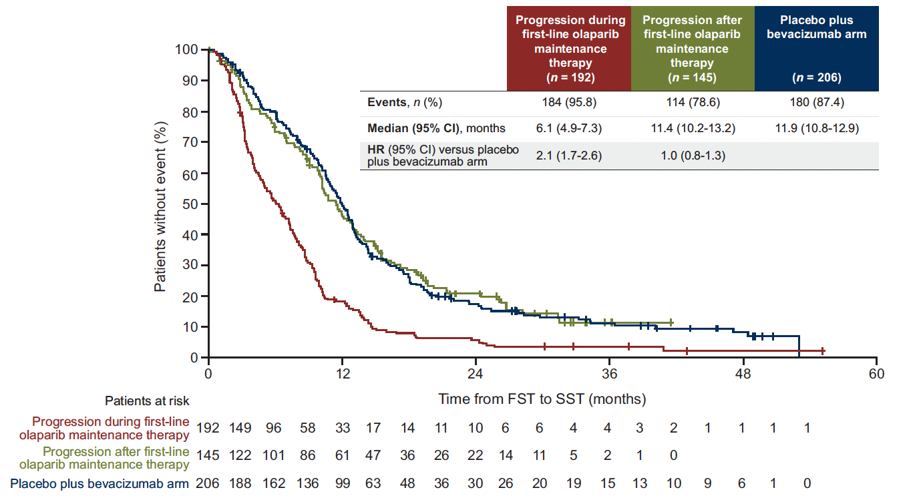
What happened?
Different patient populations?
Percentage cross-over to PARPi?
  SOLO1 44.3% placebo; 14.6% olaparib
  PRIMA 57.7% placebo; 19.1% niraparib
Impact of PARPi on future therapies?
Harter et al., Ann Oncol 2025
Notes:
~27% of pts progressing on olap in SOLO1; ~36% of pts on niraparib PRIMA

Slide 29
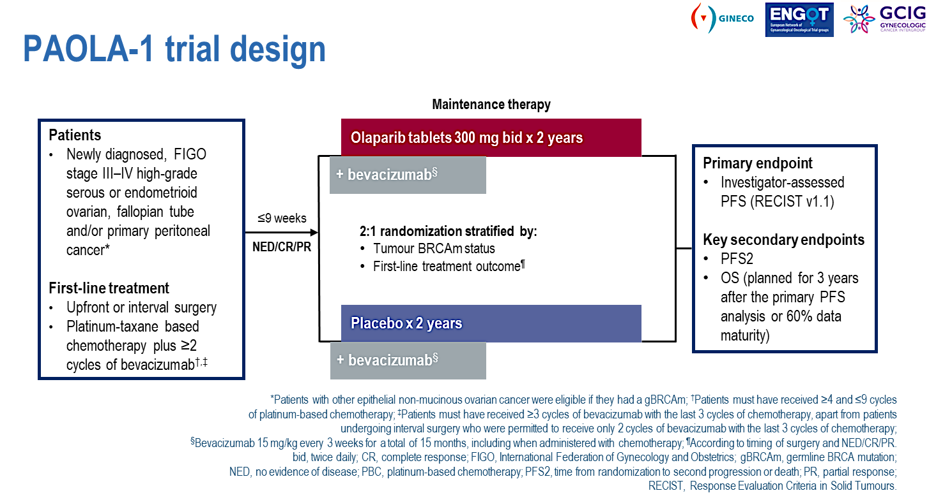
Ray-Coquard, N Engl J Med 2019

Slide 30
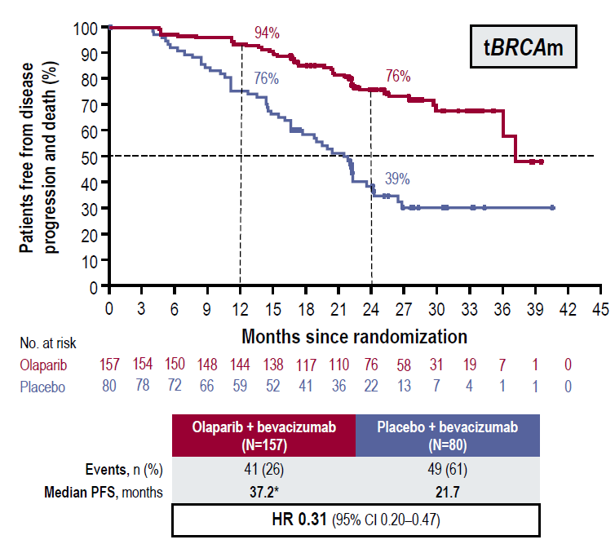
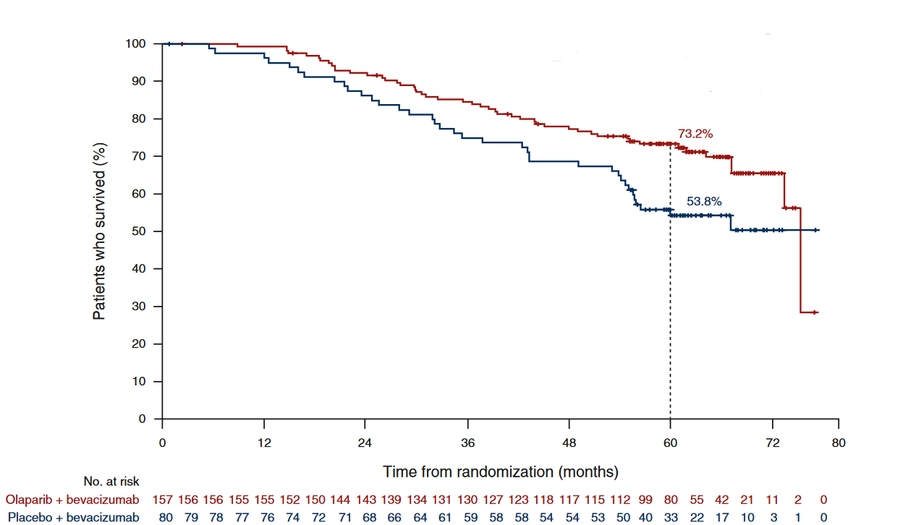
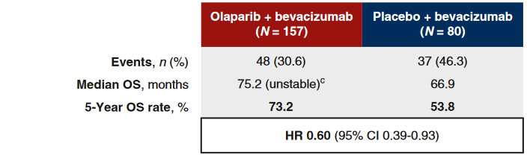
Olaparib/bevacizumab improves outcomes compared to bevacizumab in BRCAm ovarian cancer
PAOLA1: Primary PFS and Final OS analyses
Primary analysis PFS tBRCAm
Final OS analysis tBRCAm
Median PFS
21.7 vs 37.2 HR 0.31
Median OS
66.9 vs 75.2
HR 0.60
But how does it compare to olaparib alone? Unknown.
Ray-Coquard N Engl J Med 2019; Ray-Coquard Ann Oncol 2023

Slide 31
Randomized studies informing front-line PARPi maintenance
BRCAm
BRCA wt; HRD test pos
BRCA wt; HRD test neg
SOLO-1 | Olaparib
PARPi monotherapy
PRIMA | Niraparib
PRIMA | Niraparib
PRIMA | Niraparib
ATHENA-MONO | Rucaparib
ATHENA-MONO | Rucaparib
ATHENA-MONO | Rucaparib
PARPi + bevacizumab
PAOLA-1 | Olaparib + bevacizumab
PAOLA-1 | Olaparib + bevacizumab
PAOLA-1 | Olaparib + bevacizumab
ATHENA-COMBO | Rucaparib + nivolumab
ATHENA-COMBO | Rucaparib + nivolumab
ATHENA-COMBO | Rucaparib + nivolumab
DUO-O | Olaparib + bevacizumab + durvalumab
DUO-O | Olaparib + bevacizumab + durvalumab
PARPi + IO
KEYLYNK-001 | Olaparib + pembrolizumab +/- bevacizumab
KEYLYNK-001 | Olaparib + pembrolizumab +/- bevacizumab

Slide 32
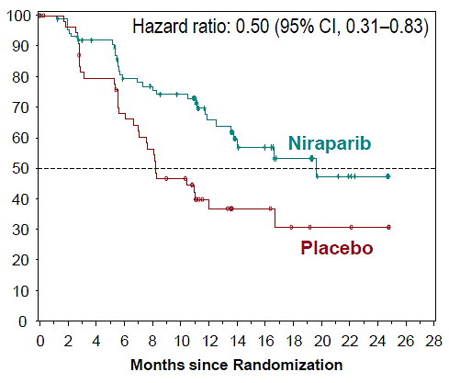
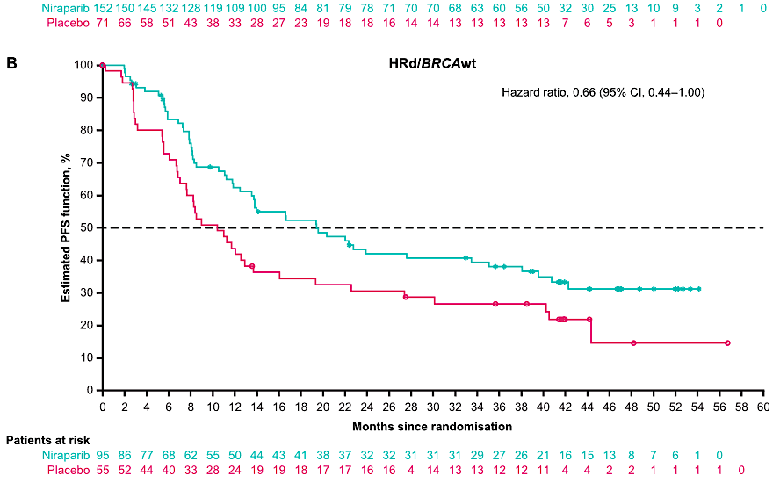
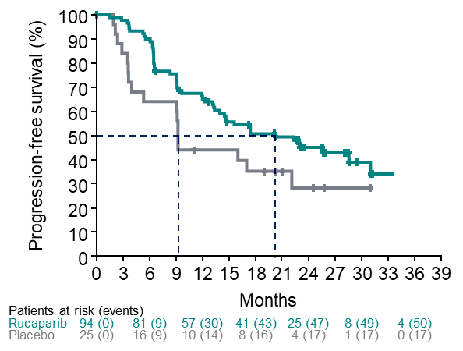
PARPi monotherapy maintenance results in PFS benefit in BRCAwt HRD test positive tumors
PRIMA
(HRD by GIS ≥42)
ATHENA-MONO
(HRD by LOH ≥16%)
Primary analysis
3.5 year follow-up
Primary analysis
Updated Median PFS:
10.4 vs 19.4 mos
HR 0.66 (95% CI 0.44-1.00)
Median PFS:
9.2 vs 20.3 mos
HR 0.58 (95% CI 0.33-1.01)
Median PFS:
8.2 vs 19.6 mos
HR 0.50 (95% CI 0.31-0.83)
Gonzalez-Martin N Engl J Med 2019; Gonzalez-Martin Eur J Cancer 2023; Monk J Clin Oncol 2022

Slide 33
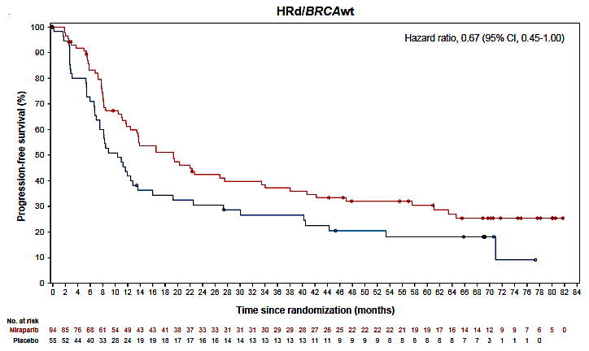
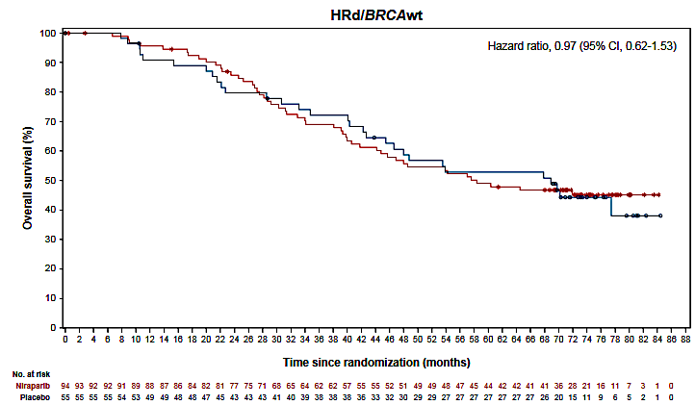
No OS benefit for niraparib maintenance in BRCAwt HRD test positive tumors
PRIMA Final OS Analysis: ~6.2 year follow-up
PFS HRD/BRCAwt
OS HRD/BRCAwt
Median PFS
10.4 vs 19.4 mos
HR 0.67
(95% CI 0.45-1.00)
HR 0.97
(95% CI 0.62-1.53)
Gonzalez-Martin, 2024 ESMO Congress; Monk et al., Ann Oncol 2024

Slide 34
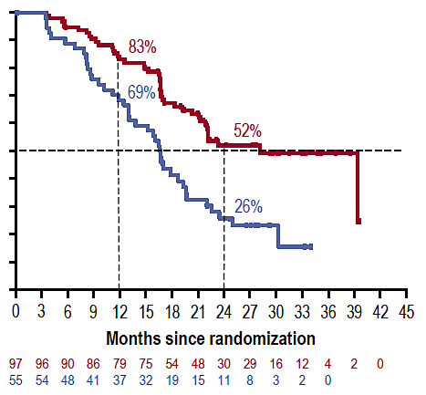
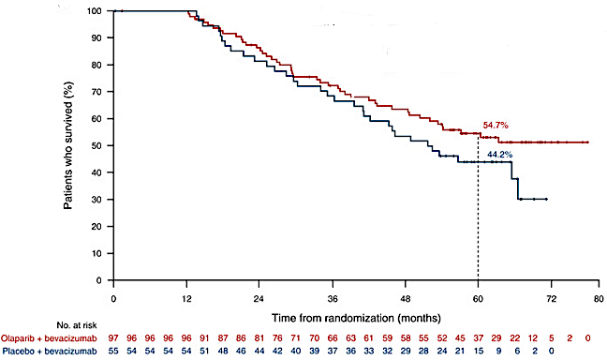
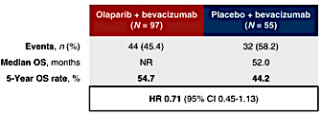
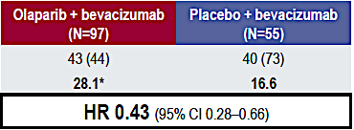
Olaparib/bevacizumab improves outcomes compared to bevacizumab in BRCAwt HRD test positive ovarian cancer
PAOLA1: Primary PFS and Final OS analyses
Primary analysis PFS BRCAwt, HRD+
Final OS analysis BRCAwt, HRD+
Median PFS
28.1 vs 16.6
HR 0.43 (0.28-0.66)
Median OS
NR vs 52.0
HR 0.71 (95% CI 0.45-1.13)
Ray-Coquard N Engl J Med 2019; Ray-Coquard Ann Oncol 2023

Slide 35
Randomized studies informing front-line PARPi maintenance
BRCAm
BRCA wt; HRD test pos
BRCA wt; HRD test neg
SOLO-1 | Olaparib
PARPi monotherapy
PRIMA | Niraparib
PRIMA | Niraparib
PRIMA | Niraparib
ATHENA-MONO | Rucaparib
ATHENA-MONO | Rucaparib
ATHENA-MONO | Rucaparib
PARPi + bevacizumab
PAOLA-1 | Olaparib + bevacizumab
PAOLA-1 | Olaparib + bevacizumab
PAOLA-1 | Olaparib + bevacizumab
ATHENA-COMBO | Rucaparib + nivolumab
ATHENA-COMBO | Rucaparib + nivolumab
ATHENA-COMBO | Rucaparib + nivolumab
DUO-O | Olaparib + bevacizumab + durvalumab
DUO-O | Olaparib + bevacizumab + durvalumab
PARPi + IO
KEYLYNK-001 | Olaparib + pembrolizumab +/- bevacizumab
KEYLYNK-001 | Olaparib + pembrolizumab +/- bevacizumab

Slide 36
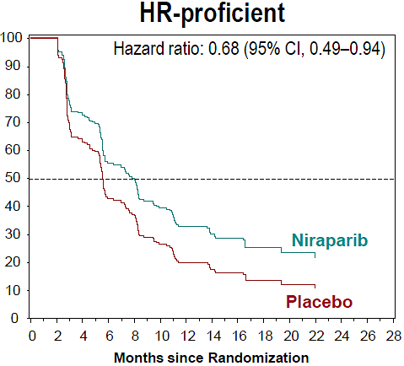
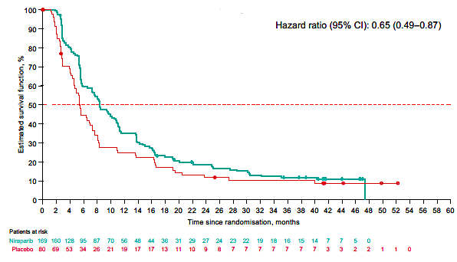
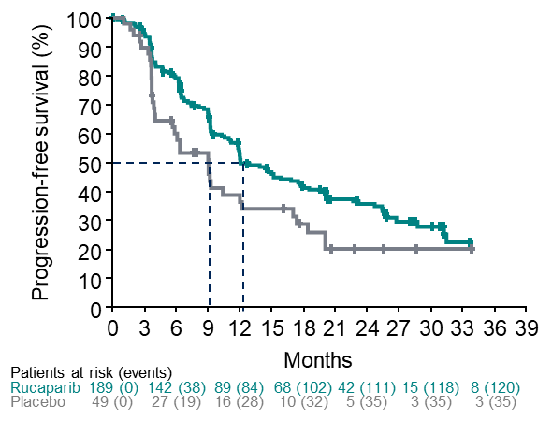
PARPi monotherapy maintenance has limited PFS benefit in BRCAwt HRD test negative tumors
PRIMA
(HRD test neg; GIS <42)
ATHENA-MONO
(HRD test neg; LOH <16%
Primary analysis
3.5 year follow-up
Primary analysis
Median PFS:
5.4 vs 8.1 mos
HR 0.68 (95% CI 0.49-0.94)
Updated Median PFS:
5.4 vs 8.4 mos
HR 0.65 (95% CI 0.49-0.87)
Median PFS:
9.1 vs 12.1 mos
HR 0.65 (95% CI 0.45-0.95)
Median OS 36.6 vs 32.2 mos
HR 0.93 (95% CI 0.69-1.26)
Gonzalez-Martin N Engl J Med 2019; Gonzalez-Martin Eur J Cancer 2023; Monk J Clin Oncol 2022; Gonzalez-Martin 2024 ESMO Congress; Monk Ann Oncol 2024

Slide 37
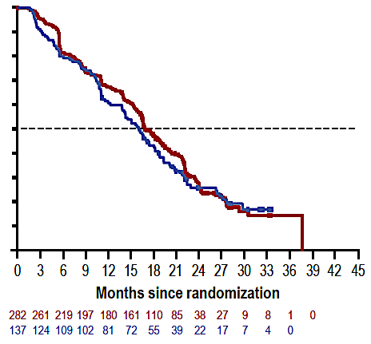
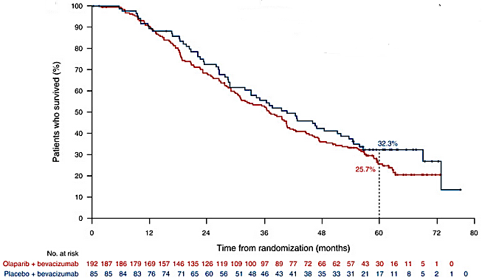
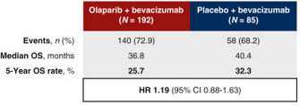
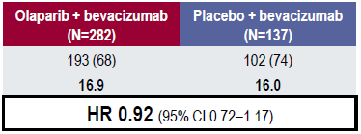
Olaparib/bevacizumab does not improve outcomes compared to bevacizumab in BRCAwt, HRD test negative ovarian cancer
PAOLA1: Primary PFS and Final OS analyses
Primary analysis PFS BRCAwt, HRD test neg
Final OS analysis BRCAwt, HRD test neg
Median PFS
16.9 vs. 16.0
HR 0.92 (0.72-1.17)
Median OS
25.7 vs 32.3
HR 1.19 (95% CI 0.88-1.63)
Ray-Coquard N Engl J Med 2019; Ray-Coquard Ann Oncol 2023

Slide 38
Randomized studies informing front-line PARPi maintenance
BRCAm
BRCA wt; HRD test pos
BRCA wt; HRD test neg
SOLO-1 | Olaparib
PARPi monotherapy
PRIMA | Niraparib
PRIMA | Niraparib
PRIMA | Niraparib
ATHENA-MONO | Rucaparib
ATHENA-MONO | Rucaparib
ATHENA-MONO | Rucaparib
PARPi + bevacizumab
PAOLA-1 | Olaparib + bevacizumab
PAOLA-1 | Olaparib + bevacizumab
PAOLA-1 | Olaparib + bevacizumab
ATHENA-COMBO | Rucaparib + nivolumab
ATHENA-COMBO | Rucaparib + nivolumab
ATHENA-COMBO | Rucaparib + nivolumab
DUO-O | Olaparib + bevacizumab + durvalumab
DUO-O | Olaparib + bevacizumab + durvalumab
PARPi + IO
KEYLYNK-001 | Olaparib + pembrolizumab +/- bevacizumab
KEYLYNK-001 | Olaparib + pembrolizumab +/- bevacizumab

Slide 39
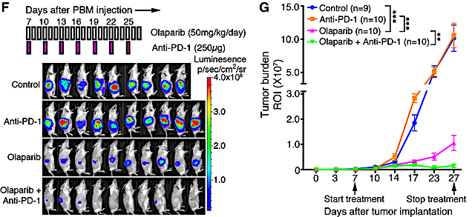
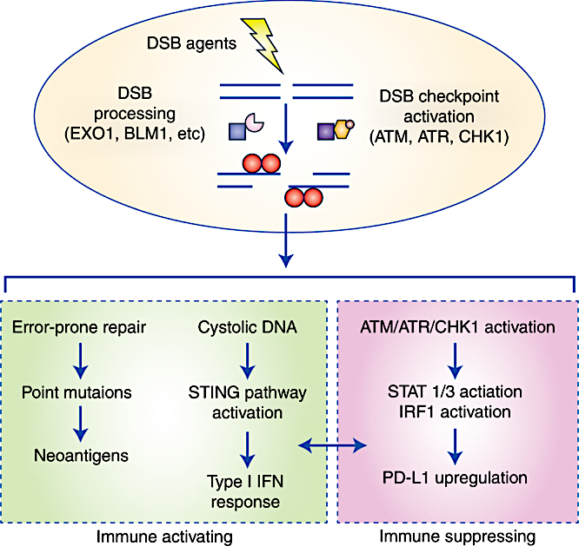
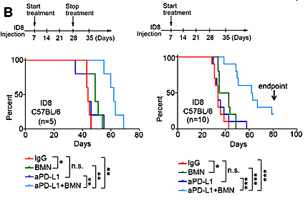
Immunotherapy + PARP inhibitors
Luminescence
Ding L et al., Cell Rep. 2018
Point mutations
STAT 1/3 activation
Mouw and Konstantinopoulos, Brit J Cancer 2018
Shen et al., Cancer Res 2019

Slide 40
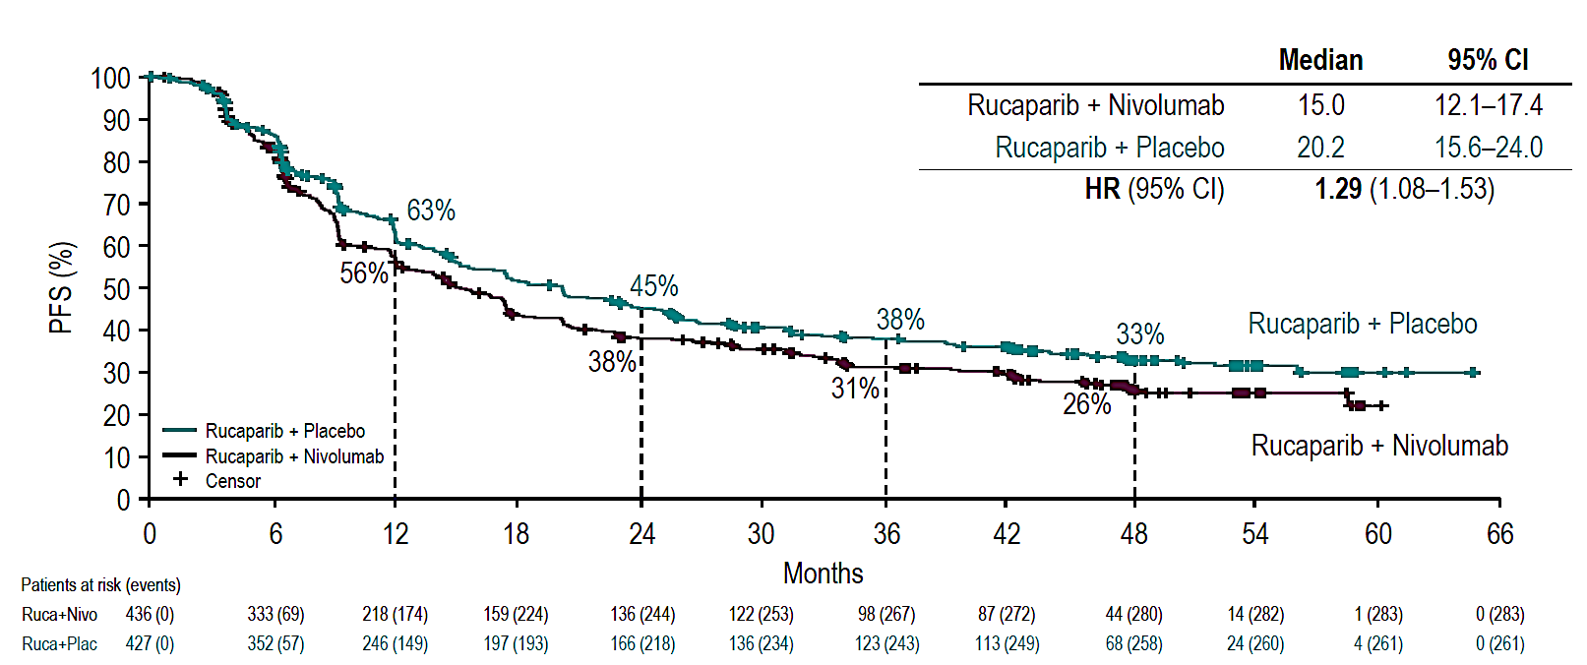
Rucaparib + nivolumab did not improve PFS compared to rucaparib alone
ATHENA-COMBO
PFS ITT
 | Rucaparib/ Nivolumab (N=410) | Rucaparib/ Placebo (N=448)
Oral drug interruption and/or dose reduction for TEAE | 321 (78.3) | 283 (63.2)
Oral drug d/c for TEAE | 104 (25.4) | 66 (14.7)
IV drug d/c for TEAE | 145 (35.4) | 43 (9.6)
Oral and IV drug d/c for TEAE | 63 (15.4) | 19 (4.2)
HR 1.29!!!
15.0 vs 20.2 mo PFS
Monk et al., 2024 ESMO Congress

Slide 41
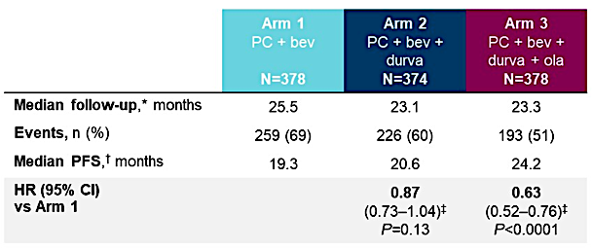
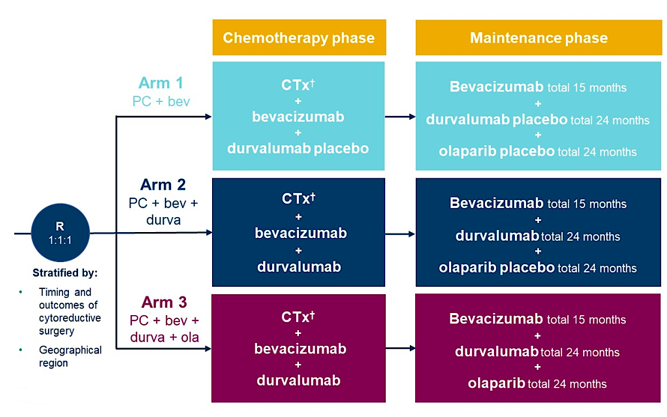
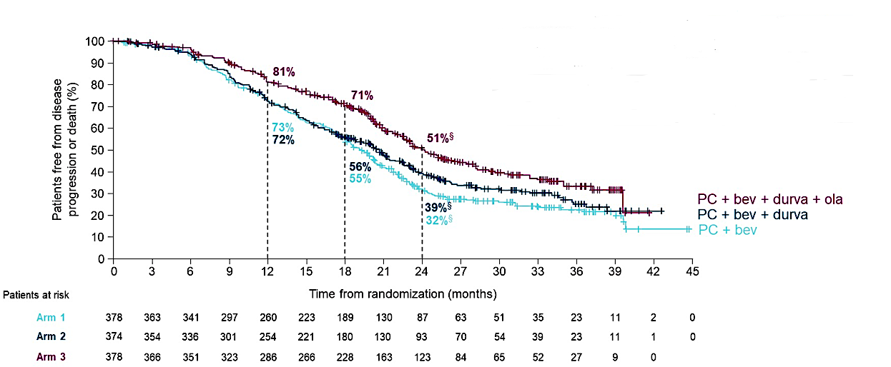
DUO-O demonstrated PFS improvement with olaparib + dostarlimab + bevacizumab
HR
0.63
…but we do not have the control arms to tell us this could not be from olaparib or olaparib + bevacizumab
Harter et al., 2023 ASCO Annual Meeting

Slide 42
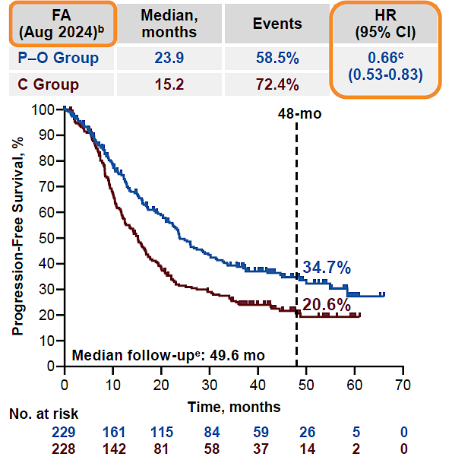
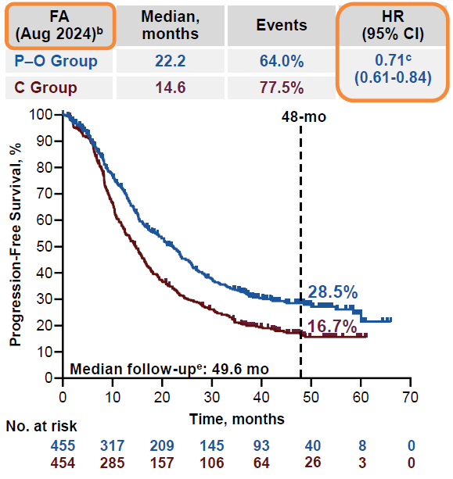
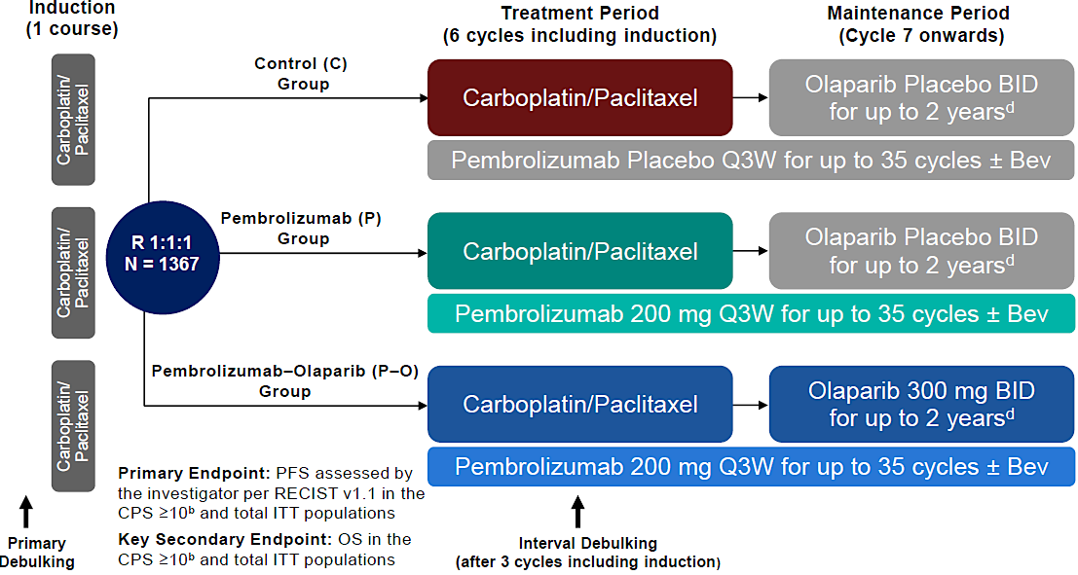
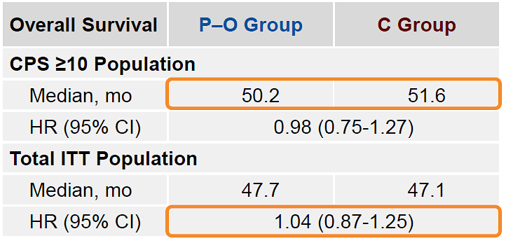
KEYLYNK-001 demonstrated PFS improvement with olaparib + pembrolizumab (+/- bevacizumab)
CPS ≥10
HR 0.66
ITT
HR 0.71
…but we still do not have the control arms to tell us this could not be from olaparib or olaparib + bevacizumab
Powell et al., 2025 SGO Annual Meeting

Slide 43
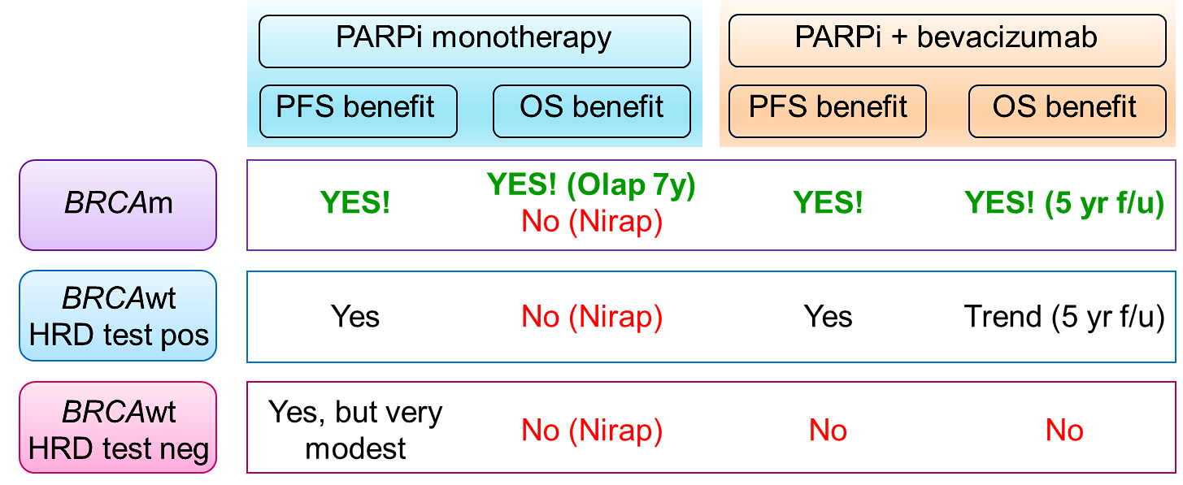
Front-line maintenance: where are we, and what’s still ahead?
Test for BRCA mutations and HRD status
The Present State
Still to Come…
PARPi monotherapy OS
ATHENA-MONO | Rucaparib
PARPi vs. PARPi + bev
NIRVANA-1 | Niraparib +/- bev
AGO-OVAR 28 | Niraparib +/- bev
MITO25 | Rucaparib +/- bev vs bev
PARPi + ICI +/- bev
FIRST | Niraparib + dostarlimab +/- bev

Slide 44

Where do we go from here?
Optimal duration of therapy
  NRG-GY036: One vs. two years of maintenance olaparib
Identify patients at risk for early progression and those with exceptional prognosis
27% progressing on PARPi
20% disease-free on placebo

Slide 45

Where do we go from here?
Optimal duration of therapy
  NRG-GY036: One vs. two years of maintenance olaparib
Identify patients at risk for early progression and those with exceptional prognosis
Options for patients with HRP tumors
  ADC maintenance?

Slide 46
Case Presentation: 65-year-old woman (PS 1) with moderate ascites and omental caking is diagnosed with HRD-positive, BRCA wild-type HGSOC
Dr Karim ElSahwi (Neptune City, New Jersey)

Slide 47
Questions for the Faculty
How do you decide whether to start with neoadjuvant chemotherapy versus primary debulking surgery for patients with newly diagnosed advanced ovarian cancer?
If you opt for neoadjuvant chemotherapy, in which situations, if any, do you use HIPEC?
How much stock do you put in genomic testing platforms other than the companion diagnostics used in the pivotal clinical trials? Are they equally effective?

Slide 48
Questions for the Faculty
What maintenance therapy would you recommend for this patient? Which PARP inhibitor would you prefer? Would you continue bevacizumab in the maintenance setting? How long would you continue maintenance therapy?
How, if at all, would your approach to maintenance therapy differ if this patient had a germline or somatic BRCA mutation?
Do you think regimens combining PARP inhibitors with immune checkpoint inhibitors may eventually have a role in newly diagnosed advanced ovarian cancer? Are there any patient subsets for whom these strategies seem more promising?

Slide 49
Case Presentation: 73-year-old woman with BRCA wild-type Stage IIIC HGSOC (HRD status inconclusive twice) receives carboplatin/paclitaxel and interval debulking surgery
Dr Kellie Schneider (Charlotte, North Carolina)

Slide 50
Questions for the Faculty
Have you encountered inconclusive HRD results? Are there any steps that can be taken to increase the likelihood of obtaining interpretable HRD test results?
Would you have recommended maintenance therapy for this patient, and if so, what?
How would you have managed this patient’s thrombocytopenia? Would you have switched to another PARP inhibitor, continued niraparib at a lower dose or discontinued maintenance therapy?

Slide 51
Questions for the Faculty
How often do you order CBCs for patients receiving up-front PARP inhibitor maintenance? Is there any way to anticipate which patients will experience cytopenias?
Would you ever continue up-front PARP inhibitor maintenance beyond the recommended duration for patients who are tolerating therapy well and are nervous about stopping?

Slide 52
Agenda
MODULE 1: Up-Front Treatment for Advanced Ovarian Cancer (OC) — Dr Liu
MODULE 2: Current Management of Relapsed/Refractory (R/R) OC; Promising Novel Agents and Strategies Under Investigation — Dr O’Malley
MODULE 3: Role of HER2-Targeted Therapy in Advanced OC, Endometrial Cancer (EC) and Other Gynecologic Cancers — Dr Santin
MODULE 4: First-Line Therapy for Advanced EC — Dr Westin
MODULE 5: Current Therapeutic Options for R/R EC; Novel Investigational Strategies for Newly Diagnosed and Recurrent Disease — Dr Salani

Slide 53
Current Management of Relapsed/Refractory Ovarian Cancer
Promising Novel Agents and Strategies Under Investigation
David M O’Malley, MD
The Ohio State University and
The James Comprehensive Cancer Center
Columbus, Ohio

Slide 54
Agenda
Antibody Drug Conjugates
  Folate Receptor Alpha
  CDH6
  Others
Glucocorticoid receptor antagonist
  Relacorilant
  Phase III ROSELLA trial of relacorilant in combination with nab paclitaxel
Immune therapies
  Phase 3 KEYNOTE-B96
Post ADC World?

Slide 55

How common is FRα expressed in Ovarian Cancer?
EOC expression from the STRO-002-GM1 and STRO-002-GM2 trials
Approximately 40% will have high expression based PS2+ scoring (Abstract 5568, T. Krivak, et al) in real world analysis
80%-90%+ will have some FRα expression
T. Krivak, et al. Abstract 5568 ASCO 2025: Real-world analysis of folate receptor alpha (FRα; FOLR1) expression in pan-tumor samples from over 6000 patients in the US
A. Oakin et al 2023 “Luveltamab tazevibulin (STRO-002), an anti-folate receptor alpha (FolRα) antibody drug conjugate (ADC), safety and efficacy in a broad distribution of FolRα expression in patients with recurrent epithelial ovarian cancer (OC): Update of STRO-002-GM1 phase 1 dose expansion cohort. https://www.sutrobio.com/wp-content/uploads/2024/11/HP_Luvelta_ADC-World_11-07-2025_FINAL.pdf

Slide 56


Mirvetuximab Soravtansine Improved PFS and OS¹
INV-PFS: Primary Endpoint
MIRASOL
35% improvement
in PFS with MIRV vs chemotherapy
33% improvement
in OS with MIRV vs chemotherapy
ORR more than doubled: 42% vs 16% with MIRV vs chemotherapy (P < .0001; 12 CRs vs 0 CRs)
 | MIRV (n = 227) | IC Chemo (n = 226)
mPFS (95% CI) | 5.62 (4.34-5.95) | 3.98 (2.86-4.47)
Events, n (%) | 176 (77.5) | 166 (73.5)
HR (95% CI) | 0.65 (0.52-0.81)
P | <.0001
 | MIRV (n = 227) | IC Chemo (n = 226)
mOS (95% CI) | 16.46 (14.46-24.57) | 12.75 (10.91-14.36)
Events, n (%) | 90 (39.6) | 114 (50.4)
HR (95% CI) | 0.67 (0.50-0.89)
P | .0046
FDA Approval April 2024
OS: Key Secondary Endpoint

Slide 57

Safety and tolerability of mirvetuximab soravtansine monotherapy for folate receptor alpha–expressing recurrent ovarian cancer: An integrated safety summary. KN Moore, et al. Gynecologic Oncology 191, 249-258

Slide 58


Targeting FRα in Ovarian Cancer: What is next?
 | Rina-S 100 mg/m² (n=22)ª | Rina-S 120 mg/m² (n=18)ª
Median on-study follow-up, weeks (range) | 46.4 (6.6, 65.3) | 48.1 (10.9-65.9)
Confirmed ORR^{b}, % (95% CI) | 22.7 (7.8-45.4) | 55.6 (30.8-78.5)
Confirmed response, n (%)
CR | 1 (4.5) | 2 (11.1)
PR | 4 (18.2) | 8 (44.4)
SD | 14 (63.6) | 6 (33.3)
NE | 0 | 1 (5.6)
Disease control rate, % (95% CI) | 86.4 (65.1-97.1) | 88.9 (65.3-98.6)
Rinatabart sesutecan (Rina-S)
Lee, EK, SGO 2025

Slide 59
Efficacy of Rina-S Compared to Treatment of Investigator's Choice in Participants with PROC: ENGOT-OV86/GOG-3107/RAINFOL-OV2
Phase 3
Platinum Resistant Ovarian Cancer
(N=530)
RINA-S™ 120mg/m2 IV
Randomized 1:1
Investigator’s Choice of chemotherapy
Paclitaxel IV
Topotecan IV
Pegylated liposomal doxorubicin IV
Gemcitabine IV
Evaluation of Study Objectives*
Key Inclusion Criteria*
Primary Outcome Measure
Progression-Free Survival
Histologically or cytologically confirmed high grade serous or endometrioid epithelial ovarian cancer, primary peritoneal cancer, or fallopian tube cancer
Received 1 to 4 prior lines of therapy with the following therapies:
Platinum chemotherapy
Bevacizumab (if applicable)
Poly-ADP ribose polymerase (PARP) inhibitor (if applicable)
MIRV (if eligible based on FRα expression test)
Platinum-resistant disease
No prior ADC therapy containing a topoisomerase 1 inhibitor
No known active central nervous system metastases or carcinomatous meningitis
Secondary Outcome Measures
Overall Survival
Objective Response Rate
Duration of Response
CA-125 response by GCIG criteria
Adverse Events
GHS/Qol (EORTC-QLQ-C30)
NCT06619236
NCT06619236. Accessed from: https://clinicaltrials.gov/study/NCT06619236.

Slide 60
Other FRα targeted ADC presented at ASCO 2025
BAT8006
LY4170156
Songling Zhang, et al. Safety and efficacy of BAT8006, a folate receptor α (FRα) antibody drug conjugate, in patients with platinum-resistant ovarian cancer: Update on the dose optimization/expansion cohort of BAT-8006-001-CR trial.
Isabelle Ray-Coquard, David O'Malley, et al. Initial results from a first-in-human phase 1 study of LY4170156, an ADC targeting folate receptor alpha (FRα), in advanced ovarian cancer and other solid tumors.
ASCO 2025

Slide 61

Targeting Cadherin 6 (CDH6)

Slide 62

Targeting Cadherin 6 (CDH6) in Ovarian Cancer: Why?
CDH6 is part of the cadherin family, which is involved with cell-cell adhesion, organ development, and epithelial-mesenchymal transition
Function of CDH6 has yet to be fully elucidated
CDH6 is overexpressed in various cancers, particularly EOC
Expression of CDH6 is observed in ~65–85% of patients with OVC
Hirokazu S, et al. Presented at European Society for Medical Oncology (ESMO) Annual Meeting; 16-21 September 2021; Paris, France. [Abstract 10P].
Bartolomé RA, et al. Mol Oncol. 2021;15:1849–1865;
Shintani D, et al. Gynecol Oncol. 2022;166(Suppl. 1):S116;

Slide 63


Targeting CDH6
 | Raludotatug deruxtecan (DS-6000)^{1,2}
Payload | Topoisomerase 1 inhibitor (DXd)
DAR | 8
Linker | Cleavable tetrapeptide based linker
Trial | NCT04707248
1. Moore K, et al. Presented at European Society for Medical Oncology (ESMO) Annual Meeting; 20-24 October 2023; Madrid, Spain.;
2. NCT04707248. Accessed from: https://clinicaltrials.gov/study/NCT04707248?cond=NCT04707248&rank=1.

Slide 64

Raludotatug Deruxtecan Safety Profile
Moore K, et al. Presented at European Society for Medical Oncology (ESMO) Annual Meeting; 20-24 October 2023; Madrid, Spain.

Slide 65
REJOICE-Ovarian01/GOG-3096: Phase 2/3 Randomized Study of R-DXd in Platinum-Resistant EOC
Key eligibility criteria:
High-grade serous or endometrioid ovarian, primary peritoneal, or fallopian tube cancer
1−3 prior LOT (inc. bevacizumab)
Platinum-resistant disease
Prior MIRV if high FRαª
ECOG PS 0−1
No prior CDH6-targeting agents or ADCs with linked TOPO I inhibitor
Patients with primary platinum-refractory disease are not eligible
40D
LTSFU Q3M
40D
LTSFU Q3M
Phase 2
Follow-up
Phase 3
Follow-up
R-DXd IV Q3W
R-DXd IV Q3W
4.8 mg/kg
R-DXd at RP3D
R
1:1:1
5.6 mg/kg
R
1:1
TPC
(gemcitabine, PLD, topotecan, paclitaxel)
6.4 mg/kg
Until PD,^{b} death, lost to FU, other reason
Until PD,^{b} death, lost to FU, other reason
Stratification:
Number of prior LOT (1 vs 2/3)
CDH6 expression (high vs low)
TPC (paclitaxel vs others; Ph 3 only)
Primary endpoint:
ORR per BICR^{b}
Key secondary endpoints:
ORR per inv^{b}
DOR
Primary endpoints:
ORR per BICR^{b}
PFS per BICR^{b}
Key secondary endpoints:
OS
QOL
NCT06161025
NCT06161025. Accessed from: https://clinicaltrials.gov/study/NCT06161025?term=NCT06161025&rank=1.
Notes:
We are excited to present the Phase 2/3, REJOICE-Ovarian01 (NCT06161025) study, to further evaluate the efficacy and safety of R-DXd in patients with platinum-resistant OVC
The study has been initiated globally and sites are expected to open in North America, South America, Europe, and Asia

Slide 66
Glucocorticoid receptor antagonist

Slide 67

Primary Endpoint Met in the Pivotal Phase 3 ROSELLA Trial of Relacorilant
Patients with Platinum-Resistant Ovarian Cancer
ROSELLA, a pivotal Phase 3 trial of relacorilant plus nab-paclitaxel in patients with platinum-resistant ovarian cancer, met its primary endpoint of improved progression-free survival, as assessed by blinded independent central review (PFS-BICR).
In ROSELLA, patients treated with relacorilant in addition to nab-paclitaxel chemotherapy experienced a 30 percent reduction in risk of disease progression compared to patients treated with nab-paclitaxel alone (hazard ratio: 0.70; p-value: 0.008). Their median PFS-BICR was 6.5 months, compared to 5.5 months in patients who received nab-paclitaxel alone. At an interim evaluation of overall survival (OS), patients treated with relacorilant plus nab-paclitaxel had a significant improvement in OS, with a median OS of 16.0 months, compared to 11.5 months for patients receiving nab-paclitaxel alone (hazard ratio: 0.69; p-value: 0.012). Relacorilant was well-tolerated and no new safety signals were observed. As was the case in the company’s Phase 2 trial, safety and tolerability were comparable in the two groups.
https://ir.corcept.com/news-releases/news-release-details/primary-endpoint-met-corcepts-pivotal-phase-3-rosella-trial

Slide 68


Outcomes are Poorer in Patients with Ovarian Cancer when GR is High or when Nocturnal Cortisol is High
Median PFS was 15 months shorter in patients with high tumor GR expression compared to those with low tumor GR expression (p < 0.001)
Median survival for patients with high nocturnal cortisol (3.3 years, 95% CI=2.6, 3.8 years) vs. with low nocturnal cortisol (7.3 years, 95% CI =3.8, 10.8 years). Cox regression adjusted for covariates indicates that patients with lower nocturnal cortisol had longer survival times (p=.021).
Veneris, Gynecol Oncol 2017
Schrepf, Psychoneuroendocrinology, 2015

Slide 69

Relacorilant + Nab-paclitaxel Phase 2 Study Design
:
D Lorusso Previously reported at ESMO 2021

Slide 70


INTERMITTENT Relacorilant + Nab-paclitaxel
Improved Progression-Free Survival
While ORR was similar, DoR was significantly improved in the INTERMITTENT vs the COMPARATOR arm.
HR 0.36, 95%
CI (0.16-0.77), P=0.006
CONTINUOUS: once-daily relacorilant + nab-paclitaxel; INTERMITTENT: intermittent relacorilant + nab-paclitaxel; COMPARATOR: nab-paclitaxel monotherapy
D Lorusso Previously reported at ESMO 2021

Slide 71


INTERMITTENT Relacorilant + Nab-Paclitaxel Improved OS
In the INTERMITTENT arm, 27% of patients were still alive at 24 months compared to 14% in the COMPARATOR arm.
Trend toward improved OS consistent at interim and final analyses.
CONTINUOUS: once-daily relacorilant + nab-paclitaxel; INTERMITTENT: intermittent relacorilant + nab-paclitaxel; COMPARATOR: nab-paclitaxel monotherapy
D Lorusso Previously reported at ESMO 2021

Slide 72

ROSELLA Phase 3 Study Schema
Primary Endpoint:
  Progression free survival (BICR) per RECIST v1.1
Secondary Endpoints:
  Overall Survival
  Progression-Free Survival (by INV) per RECIST v1.1
  Overall Response Rate per RECIST v1.1, BOR
  Duration of Response per RECIST v1.1
  Clinical Benefit Rate per RECIST v1.1
  Combined response according to RECIST v1.1 + GCIG criteria
Safety Endpoints:
  QOL, CA125, PD, PK
Patient Population:
HG serous, Endometrioid epithelial ovarian, primary peritoneal,
or fallopian tube cancer
Progression ≤ 6 months after last dose of plat-based therapy (exclude primary-platinum refractory)
Have received prior bevacizumab
BICR: Blinded Independent Central Review; INV: Investigator; RECIST: Response Evaluation Criteria in Solid Tumors;
GCIG: Gynecologic Cancer Intergroup
Collaborative Group Collaboration:
Gynecologic Oncology Group (GOG)
European Network of Gynecological Oncology Trial groups (ENGOT)
NCT05257408

Slide 73
Primary Endpoint Met in the Pivotal Phase 3 ROSELLA Trial of Relacorilant
Patients with Platinum-Resistant Ovarian Cancer
ROSELLA, a pivotal Phase 3 trial of relacorilant plus nab-paclitaxel in patients with platinum-resistant ovarian cancer, met its primary endpoint of improved progression-free survival, as assessed by blinded independent central review (PFS-BICR).
In ROSELLA, patients treated with relacorilant in addition to nab-paclitaxel chemotherapy experienced a 30 percent reduction in risk of disease progression compared to patients treated with nab-paclitaxel alone (hazard ratio: 0.70; p-value: 0.008). Their median PFS-BICR was 6.5 months, compared to 5.5 months in patients who received nab-paclitaxel alone. At an interim evaluation of overall survival (OS), patients treated with relacorilant plus nab-paclitaxel had a significant improvement in OS, with a median OS of 16.0 months, compared to 11.5 months for patients receiving nab-paclitaxel alone (hazard ratio: 0.69; p-value: 0.012). Relacorilant was well-tolerated and no new safety signals were observed. As was the case in the company’s Phase 2 trial, safety and tolerability were comparable in the two groups.
https://ir.corcept.com/news-releases/news-release-details/primary-endpoint-met-corcepts-pivotal-phase-3-rosella-trial

Slide 74
Immune Therapy

Slide 75

A road for IO in PROC?
ENGOT-ov65/KEYNOTE-B96: Phase 3, Randomized, Double-Blind Study of Pembrolizumab Versus Placebo Plus Paclitaxel With Optional Bevacizumab for Platinum-Resistant Recurrent Ovarian Cancer
N. Colombo, ESGO 2022

Slide 76

A road for IO in PROC?
ENGOT-ov65/KEYNOTE-B96: Phase 3, Randomized, Double-Blind Study of Pembrolizumab Versus Placebo Plus Paclitaxel With Optional Bevacizumab for Platinum-Resistant Recurrent Ovarian Cancer
N. Colombo, ESGO 2022

Slide 77
What about the post ADC world?

Slide 78

Targeting WEE1 with Azenosertib Exploits Critical Cell Cycle Checkpoints that Cyclin E1 Overexpressing Cells Require for Survival
Cyclin E1 protein overexpression results in cells moving prematurely from G1
to S, there by increasing reliance on the G2-M checkpoint to allow DNA repair^{1,2}
WEE1 is a master regulator of the cell cycle acting as a brake at G1-S and
G2-M to allow DNA repair³
Targeting WEE1 with azenosertib ultimately leads to mitotic catastrophe⁴
CDK, cyclin-dependent kinase; G1-S, Gap 1-Synthesis; G2-M, Gap 2-Mitosis; HGSOC, high-grade serous ovarian cancer.
1. Vriend LE, et al. Biochim Biophys Acta. 2013; 1836(2):227-335. 2. Esposito F, et al. Int J Mol Sci. 2021;22(19):10689. 3. Gorski JW, et al. Diagnostics (Basel). 2020;10(5):279. 4. Kim D, et al. NPJ Precis Oncol. 2025;9(3).
F. Simpkins, SGO 2025
Notes:
-Cyclin E1 protein OE leads to cell cycle dysregulation, cells move prematurely from G1 into S phase.
- Leading to high levels of replication stress, and critical reliance on G2-M checkpoint activation for DNA repair
WEE1 is a key regulator activating the G1-S and G2-M checkpoints
Targeting WEE1 with azenosertib, results in loss of the cell cycle checkpoints, mitotic catastrophe and cell death.

Slide 79
DENALI (GOG-3066): Phase 2, Open-Label, Multicenter Study
of Azenosertib in PROC (Part 1 and 2)
Key eligibility criteria
Part 1b: Study design
Enrollment complete
PROC
1-5 prior lines of therapy
Prior bevacizumab
All comers (irrespective Cyclin E1 status)
Enrollment
(N=102)
Azenosertib
400 mg QD 5:2
Endpoints
Safety and tolerability
ORR, DORª
PFS^{b}
NCT05128825
Data cut-off Jan, 2025
Part 2a
Part 2b^{c}
Azenosertib
400 mg 5:2
Azenosertib
(Dose TBD)
Endpoints
Patients with
Cyclin E1+ tumors
ORR, DOR
Prescreening/
Tissue Consent
1:1 randomization
Interim Analysis
PFS
Azenosertib
300 mg 5:2
Safety and tolerability
ªPer RECIST v1.1 by ICR and investigator every 6 weeks until disease progression, death from any cause (ORR: up to 12 months; DOR: up to 60 months). ^{b}Per RECIST v1.1 by ICR and investigator every 6 weeks until disease progression, death from any cause up to 12 months. ^{c}Subject to FDA feedback. 5:2, 5 days on, 2 days off; DOR, duration of response; ICR, independent committee review; ORR, objective response rate; PFS, progression-free survival; PROC, platinum-resistant ovarian cancer; QD, once daily; RECIST, Response Evaluation Criteria in Solid Tumors; TBD, to be determined. ClinicalTrials.gov: https://clinicaltrials.gov/study/NCT05128825
F. Simpkins, SGO 2025
Notes:
-Denali GOG 3066, is a Phase II multicenter study evaluating WEE1i, azenosertib in PROC.
-This am, I will present results of Part 1B.
-Key eligibility criteria were …….PROC, no more than 5 priors, prior bev req, an ALL COMER or a NON –biomarker selected population
However tumor was required for CCNE1 CN by NGS and Cyclin E1 protein by IHC for planned assessment retrospectively
102 pts were treated with azenosertib 400 mg 5/2 off 21 day cycle, end points are as shown
______________
Primary endpoint safety and tolerability
Secondary Endpoints Objective response rate (ORR), duration of response (DOR), PFS
(data cutoff Jan, 13,2025)

Slide 80
DENALI (GOG-3066) Part 1b: Cyclin E1+ by IHC is a Biomarker Predicting Response to Azenosertib
All treated patientsª (N=102)
Biomarker positive: Cyclin E1 IHC^{b} (n=48)
ORR in response-evaluable patients
20.4%
ORR in response-evaluable patients
34.9%
Best % Change from Baseline
Cyclin E1 IHC+
+ Treatment ongoing
CCNE1 Status:
Amplified
Non-amplified
Not evaluable
 | All treated patients (N=102)
ORR in response-evaluable^{c} patients, % (n/N; 95% CI) | 20.4 (19/93; 12.8-30.1)
ORR, ITT % (n/N; 95% CI) | 18.6 (19/102; 11.6-27.6)
 | Cyclin E1 IHC+ (n=48)
ORR in response-evaluable^{c} patients, % (n/N; 95% CI) | 34.9 (15/43; 21.0-50.9)
ORR, ITT % (n/N; 95% CI) | 31.3 (15/48; 18.7-46.3)
Data cutoff date: January 13, 2025. ªFull analysis set: all treated patients. ^{b}Biomarker dataset: all treated patients with evaluable tissue and Cyclin E1 IHC status. ^{c}Includes patients who received at least one post-treatment scan.
Amp, amplified; IHC, immunohistochemistry; ORR, objective response rate; PD, progressive disease; PR, partial response.
F. Simpkins, SGO 2025
Notes:
-On the left is waterfall plot for “All Treated Patients irrespective of biomarker” showing objective response rate in evaluable patients (had at least 1 scan) was 20%. And in the ITT (received one dose) was 18.6%.
-However, in the biomarker selected, Cyclin E1 +/ or OE tumors on the right, (which represented about 50% of all PROC patients treated 48 of 102 pts), ORR in eval pts was 34.9% and ITT 31%.
--ORR for biomarker negative or Cyclin E1 IHC neg/low, was only 4.3%.
-Responses in pts with +IHC are seen independent of CCNE1 amplification status, as indicated by the purple squares at the bottom of the graph“
-These data suggest that Cyclin E1 +/OE by IHC is a biomarker predicting response to Azenosertib.
Zen Other:
Of all patients enrolled about half of the enrolled patients were characterized as Cyclin E1 positive PROC as determined by the Sponsor’s central assay.
85% of CCNE1 amp are also CyclinE1 positive (Maybe best for previous slide)
Subgroup analysis of harboring amplification at the CCNE1 gene demonstrates a comparable ORR to the Cyclin E1 IHC defined group

Slide 81
DENALI (GOG-3066): Phase 2, Open-Label, Multicenter Study Investigating Azenosertib in Cyclin E1+ PROC
Part 2
Key eligibility criteria
Part 2a
Part 2bª
PROC
Cyclin E1 +IHC
1-3 prior lines of therapy
4 if Prior mirvetuximab
Azenosertib 400 mg 5:2
Endpoints
Patients with
Cyclin E1+ tumors
Azenosertib
(dose TBD)
ORR, DOR
Prescreening/
Tissue Consent
Interim Analysis ^{b}
1:1 randomization
PFS
Azenosertib 300 mg 5:2
Safety and tolerability
NCT05128825
ªSubject to FDA feedback. ^{b}Enrollment will continue through the interim analysis
5:2, 5 days on, 2 days off; DOR, duration of response; FRa, folate receptor alpha; ORR, objective response rate; PFS, progression-free survival; PROC, platinum-resistant ovarian cancer; TBD, to be determined.
ClinicalTrials.gov: https://clinicaltrials.gov/study/NCT05128825.
F. Simpkins, SGO 2025
Notes:
Based on results from Part I, Part 2 of Denali will next evaluate Azenosertib, in \biomarker positive Cyclin E1+ PROC
-no more than 3 prior regimens, 4 if prior Mirvetuximab,
-In A pt will be randomized to 2 active doses, 300 or 400mg dose for dose optimization
-In B, the optimized dose selected and further evaluated for a total of 110 pts

Slide 82
Key Takeaways
ADCs are here to stay
Sequencing, cross resistance, biomarker status continues to be unanswered
Positive Phase 3 trials will markedly impact the PROC landscape
  Sequencing
  Clinical trial design
  Weekly taxane + ?
    Bev
    Relacorilant
    Pembro
    Combination (e.g. BELLA - NCT06906341)
    Other options
What about the post ADC world?

Slide 83
Case Presentation: 44-year-old woman with germline BRCA1 mutation and HGSOC receives treatment in 2018 with chemotherapy followed by olaparib maintenance and recurrence 1 year ago
Dr Lyndsay Willmott (Phoenix, Arizona)

Slide 84
Questions for the Faculty
In which patients, if any, would you attempt to rechallenge with a PARP inhibitor after disease progression on up-front PARP inhibitor maintenance?
How long do you continue PARP inhibitor maintenance for patients with recurrent advanced ovarian cancer?
What do you quote patients in terms of the risk of AML/MDS associated with PARP inhibitor therapy? Does this risk increase with longer exposure?

Slide 85
Case Presentation: 78-year-old woman with germline BRCA1 mutation and recurrent folate receptor alpha-positive HGSOC receives mirvetuximab soravtansine with CR but develops interstitial pneumonitis
Dr Spencer Bachow (Boca Raton, Florida)

Slide 86
Questions for the Faculty
How long would you continue mirvetuximab soravtansine for this patient who is in a complete response?
How often do patients receiving mirvetuximab soravtansine develop toxicity resulting in discontinuation? What are the most common toxicities that prompt you to discontinue mirvetuximab soravtansine?
What degree of interstitial lung disease/pneumonitis would prompt you to permanently discontinue mirvetuximab soravtansine? Is this the same paradigm that you employ for T-DXd?
Do you have any tricks of the trade for mitigating and managing the ocular toxicities associated with mirvetuximab soravtansine?

Slide 87
Agenda
MODULE 1: Up-Front Treatment for Advanced Ovarian Cancer (OC) — Dr Liu
MODULE 2: Current Management of Relapsed/Refractory (R/R) OC; Promising Novel Agents and Strategies Under Investigation — Dr O’Malley
MODULE 3: Role of HER2-Targeted Therapy in Advanced OC, Endometrial Cancer (EC) and Other Gynecologic Cancers — Dr Santin
MODULE 4: First-Line Therapy for Advanced EC — Dr Westin
MODULE 5: Current Therapeutic Options for R/R EC; Novel Investigational Strategies for Newly Diagnosed and Recurrent Disease — Dr Salani

Slide 88
Role of HER2-Targeted therapy in Advanced Gynecologic Cancers
Alessandro D. Santin, MD
Professor of Gynecologic Oncology
Department of Obstetrics, Gynecology & Reproductive Sciences
Yale University School of Medicine
New Haven, CT

Slide 89

HER2/neu in Gynecologic Cancers
The Human Epidermal Growth Factor Type II receptor (i.e., HER2/neu, encoded by the c-ErbB2 gene) is a transmembrane RECEPTOR protein including an extracellular ligand-binding domain, a membrane spanning region and an intracellular TYROSINE KINASE domain.
HER2/neu functions as a preferred partner for heterodimerisation with any of the other members of the EGF receptor family (HER1, HER3 and HER4) and thus plays an important role in coordination of the complex c-ErbB2 signaling network that is responsible for regulating cell growth and differentiation.
HER2/neu overexpression is thought to result in the tyrosine kinase becoming constitutively activated causing dysregulated gene transcription through activation of downstream protein pathways such as the PIK3CA/AKT/mTOR and RAS/RAF/MAPK.

Slide 90

Frequency of HER2 expression amplification/mutations among Uterine Cancers
27%.
Levine DA. Nature 2013

Slide 91


Incidence of HER2 amplification in USC
HER2/Neu-PIK3CA mutations in Uterine Serous Cancer
Genome stability
Zhao S. PNAS 2013

Slide 92
Incidence of HER2 amplification in Uterine and Ovarian Carcinosarcomas (CS)
Patient #1 POLE-mutated
12238–12243 | PNAS | 25, 2016 | vol. 113 | no. 43

Slide 93

Incidence of HER2 amplification in CS
16%
To resolve the evolutionary history and heterogeneity of CSs, we performed multi-region WES comprising four to five carcinoma and sarcoma areas from multiple tumors. Our NGS results unequivocally demonstrated that carcinomatous and sarcomatous elements derive from a common precursor having mutations typical of carcinomas. With the use of phylogenetic trees, we also demonstrated that divergence between carcinomatous and sarcomatous elements may happen at different time points during evolution of CSs, with some tumors diverging relatively late while others diverge early. Stable transgenic expression of
The Histone core genes H2A and H2B in a uterine serous carcinoma cell line demonstrated that mutant, but not wild-type, histones increased expression of markers of epithelial–mesenchymal transition (EMT) as well as tumor migratory and invasive properties, suggesting a role in sarcomatous transformation.
Zhao S. PNAS 2016

Slide 94


HER2 amplification in Ovarian Cancer
Genome copy number abnormalities
c-erbB2 CNV gains: ~5%
D Bell et al. Nature 474, 609-615 (2011) doi:10.1038/nature10166

Slide 95

HER2 amplification in Cervical Cancer
Gain:3.6%.
* HER2 mutations are present in ~ 6% of cervical cancers.
R D Burk et al. Nature 543, 378–384 (2017) doi:10.1038/nature21386

Slide 96
Optimal source material for and timing of HER2
testing in advanced gynecologic cancers

Slide 97
HER2/neu testing Guidelines for Gynecologic tumors
Clinicians should request HER2 testing on tumor tissue in the biopsy or resection specimens (primary or metastasis) prior to the initiation of trastuzumab/ADC therapy.
When HER2 status is being evaluated, laboratories/pathologists should perform/order IHC testing first, followed by ISH/FISH when IHC result is 2+ (equivocal). Positive (3+) or negative (0 or 1+) HER2 IHC results do not require further ISH/FISH testing.
Pathologists should identify and mark areas with strongest intensity of HER2 expression by IHC in the specimen for subsequent ISH/FISH scoring when required.
The prevalence of HER2 status may be discordant between the primary tumor and metastases in approximately 25% of cases, especially after treatment.
Per NCCN guidelines treating clinicians should offer combination chemotherapy and HER2-targeted therapy as the initial treatment for appropriate patients harboring HER2 positive advanced/recurrent USC and for any gynecologic cancer patient with recurrent tumors demonstrating HER2 2+/3+ expression by IHC.

Slide 98
Published research studies with the use of HER2-targeted strategies in advanced EC

Slide 99
GOG 181B
Phase II trial of trastuzumab in women with advanced or recurrent, HER2-positive endometrial carcinoma: a Gynecologic Oncology Group study.
The trial opened in 2000 to women with IHC-positive tumors and was later amended to include women with FISH-positive tumors.
Of the 286 tumors centrally screened 11.5% (33) were HER2-amplified. Of the 33 evaluable patients only 52% has c-erbB2 amplification by FISH and the majority had endometrial histology. No CR/PR detected.
Conclusion: Trastuzumab as a single agent did not demonstrate activity against endometrial carcinomas with HER2 overexpression or HER2 amplification.
Fleming G., et al., PMID: 19840887 PMCID: PMC2804260 DOI: 10.1016/j.ygyno.2009.09.025

Slide 100



Phase II TAPUR Trial: Endometrial Cancer Cohort
Pertuzumab + Trastuzumab for HER2/HER3-Amplified EC
Ahn ER et al. JCO Precis Oncol 2023
PR = partial response; PFS = progression-free survival; OS = overall survival

Slide 101


Clinical and Molecular characteristics associated with HER2-positive gynecologic malignancies
Solid tumors from different organs have unique characteristics of HER2 protein expression and gene amplification. Accordingly, different/specific HER2 scoring criteria should apply.
Natalia Buza, MD.
HER2 Testing in Endometrial Serous Carcinoma
Time for Standardized Pathology Practice to Meet the Clinical Demand
Arch Pathol Lab Med. 2021;145:687–691

Slide 102


Molecular characteristics of HER2 protein expression and gene amplification in USC
Unlike breast cancer, USC is highly heterogeneous in HER2/neu expression with up to 53% of HER2/neu 3+ by IHC demonstrating at least two-degree difference in staining intensity in tumor cells. Lack of Apical Her2 Staining: ~75% of Her2 positive cases.
College of American Pathologists – Biomarker Reporting Template for Gynecologic Tumors, 2025

Slide 103
CLINICAL CANCER RESERACH
Randomized Phase II Trial of Carboplatin-Paclitaxel Compared with Carboplatin-Paclitaxel-Trastuzumab in Advanced (Stage III-IV) or Recurrent Uterine Serous Carcinomas that Overexpress Her2/Neu (NCT01367002): Updated Overall Survival Analysis
Amanda N Fader ¹, Dana M Roque ², Eric Siegel ³, Natalia Buza ⁴, Pei Hui ⁴, Osama Abdelghany ⁴, Setsuko Chambers ⁵, Angeles Alvarez Secord ⁶, Laura Havrilesky ⁶, David M O'Malley ⁷, Floor J Backes ⁷, Nicole Nevadunsky ⁸, Babak Edraki ⁹, Dirk Pikaart ¹⁰, William Lowery ¹¹, Karim ElSahwi ¹², Paul Celano ¹³, Stefania Bellone ⁴, Masoud Azodi ⁴, Babak Litkouhi ¹⁴, Elena Ratner ⁴, Dan-Arin Silasi ⁴, Peter E Schwartz ⁴, Alessandro D Santin ¹⁵
PMID: 32601075 PMCID: PMC8792803 DOI: 10.1158/1078-0432.CCR-20-0953 2020 Aug 1;26(15):3928-3935.
Revision of the National Comprehensive Cancer Network (NCCN) guidelines, which are widely recognized and used as the standard for clinical policy in oncology by clinicians and payers, adding carboplatin/paclitaxel trastuzumab (2A category recommendation) as the preferred regimen for women with HER2+, advanced or recurrent USC (http://www.jnccn.org).
NRG-GY026: in HER2 positive, stage I-IV initially only USC and CS and now amended to any histology.

Slide 104
Progression-Free Survival by Treatment Arm
Advanced Disease:
1-sided log-rank P=0.013
HR 0.40 (90% CI 0.20-0.80)
Primary Efficacy Analysis:
1-sided log-rank P = 0.0052
HR 0.44 (90% CI 0.26-0.76)
12.6 months
17.9 months
8.0 months
9.3 months
Advanced/recurrent patients:
Median progression-free survival was improved by 4.6 months in patients who received trastuzumab with carboplatin-paclitaxel (12.6 months) compared to those who received carboplatin-paclitaxel alone (8.0 months) (p=0.005; hazard ratio [HR] 0.44 with 90% confidence interval [CI] of 0.26-0.76).
Advanced (stage III/IV) patients only:
Median progression-free survival was improved by 8.6 months in patients who received trastuzumab with carboplatin-paclitaxel (17.9 months) compared to those who received carboplatin-paclitaxel alone (9.3 months) (HR 0.40, 90% CI 0.20-0.80, p=0.013).
Fader AN et al. J Clin Oncol. 2018 Jul 10;36(20):2044-2051.

Slide 105

Overall Survival by Treatment Arm
Left: Among all patients, OS was 24.4 (CP) versus 29.6 (CP+T) months (HR = 0.581; 90% CI, 0.339–0.994; P = 0.0462). Right-top: Benefit was greatest in those undergoing primary therapy with advanced disease (OS 25.4 months vs. not reached; HR = 0.492; 90% CI, 0.249–0.974; P = 0.0406). Right-bottom: Benefit was not apparent in the recurrent setting (22.5 months vs. 25.0 months; HR = 0.864; 90% CI, 0.355–2.100; P = 0.3929).
Fader AN et al. Clin Cancer Res. 2020 Jun 29;26(15):3928–3935.

Slide 106
Efficacy outcomes with T-DXd among patients with advanced OC, EC and other gynecologic cancers in the DESTINY-PanTumor02 study

Slide 107

HER2/neu as Target unconjugated Antibody vs ADC
Main Mechanisms of action of Trastuzumab (unconjugated Ab) include:
1) Inhibition of tumor cell proliferation/induction of apoptosis (secondary to decreased HER2/neu receptor dimerization).
2) ADCC secondary to engagement of Fc receptors on effector cells (NK) (Dominant component of in vivo activity).
Main Mechanisms of action of ADC (T-DXd, T-DM1) include:
1) tumor cell killing directly related to its "toxic payload," which is a highly potent cytotoxic drug specifically delivered to cancer cells by the attached antibody.
2) Bystander effect: Once processed by the Tumor HER2/neu + cells, ADCs can release cytotoxic drug molecules that can diffuse out of Ag+ cells into the neighboring antigen-negative (Ag−) cells to induce their cytotoxicity.
DESTINY TRIAL: New category of targetable patients: HER2/neu 2+ FISH- patients.
Meric-Bernstam F., et al. Efficacy and Safety of Trastuzumab Deruxtecan in Patients With HER2-Expressing Solid Tumors: Primary Results From the DESTINY-PanTumor02 Phase II Trial. J Clin Oncol. 2024 Jan 1;42(1):47-58.
*HER2 IHC status was assessed centrally using HER2 HercepTest (DAKO) and scored according to gastric-specific criteria

Slide 108


DESTINY-PanTumor02: Phase II Trial of Trastuzumab Deruxtecan for Patients with HER2-Expressing Solid Tumors
IHC = immunohistochemistry; BTC = biliary tract cancer
Meric-Bernstam F et al. J Clin Oncol 2024;42(1):47-58.

Slide 109


DESTINY-PanTumor02: Survival
Endometrial
Cervical
Ovarian
PFS
OS
Meric-Bernstam F et al. J Clin Oncol 2024;42(1):47-58.

Slide 110
DESTINY-PanTumor02: Response by HER2 Expression Level (Central)
Endometrial cancer
Ovarian cancer
Cervical cancer
Confirmed ORR by INV (%)
IHC Unknown
IHC 3+
IHC 2+
IHC 1+
IHC 0
IHC 3+
IHC 2+
IHC 1+
IHC 0
IHC 3+
IHC 2+
IHC 1+
IHC 0
All
All
All
Total n in subgroup 40 13 7 4 5 1 40 8 20 8 4 40 11 19 5 5
n of responders 23 11 8 1 3 0 20 6 8 4 2 18 7 7 1 3
Median DOR, months NR NR 18.2 NR 9.9 – 14.2 NR 3.8 14.2 NR 11.3 22.1 11.3 8.3 4.5
95% CR 9.9, 9.6, 3.0, – 2.8, – 4.1, 9.3, 2.8, 8.3, 6.8, 4.4, 4.2, 2.8, – 2.6,
NE NE NE NE NE NE NE NE NE 22.1 NE NE NE
ORR = objective response rate; INV = investigator; DOR = duration of response; CR = complete response; NE = not estimable; NR = not reached
Lee J-Y et al. International Gynecological Cancer Society (IGCS) 2023.
Notes:
Trastuzumab deruxtecan (T-DXd) has demonstrated significant survival benefit for patients with HER2-expressing breast and gastric cancers. In DESTINY-PanTumor02, T-DXd demonstrated clinically meaningful response rates, progression-free survival (PFS), and overall survival (OS) in HER2-expressing tumors.
Methods
This open-label, Phase 2 study (NCT04482309) evaluated T-DXd (5.4 mg/kg Q3W) in patients across seven cohorts with HER2-expressing (immunohistochemistry [IHC] 3+/2+ by local [with retrospective central testing] or central testing) locally advanced/metastatic disease after ≥1 systemic treatment, or without alternative treatment. The primary endpoint was investigator-assessed confirmed objective response rate (ORR). Secondary endpoints included duration of response, PFS, OS, and safety. Exploratory endpoints included pharmacodynamic biomarkers.
Results
At data cutoff (June 2023), 120 patients in the endometrial, cervical, and ovarian cancer cohorts had received treatment (median follow-up [range]: 19.94 [0.8–31.1], 12.60 [0.9–31.0], and 13.13 [0.7–30.6] months, respectively). Overall, 80.8% received ≥2 prior lines of therapy. Table 1 shows efficacy outcomes by HER2 expression levels by cohort. Table 2 shows ORR by HER2 in situ hybridization (ISH) amplification and plasma HER2 amplification by cohort. Grade (G)≥3 drug-related adverse events occurred in 54/120 (45.0%) patients; adjudicated treatment-related interstitial lung disease/pneumonitis occurred in 13/120 (10.8%) patients (n=12 G≤2; n=1 G5).
Conclusion/Implications
T-DXd demonstrated clinically meaningful benefit, including responses across HER2 expression levels and in ISH+ or plasma ERBB2 amplified subgroups, and encouraging survival outcomes in patients with gynecological tumors. Safety was consistent with the known profile. These data support T-DXd as a potential treatment for patients with gynecological HER2-expressing tumors who progressed on prior therapy.
Lee J-Y, Makker V, Manso L, et al. Efficacy and safety of trastuzumab deruxtecan in patients with HER2-expressing solid tumors: results from the cervical, endometrial, and ovarian cancer cohorts of the DESTINY-PanTumor02 study. Presented at: Annual Global Meeting of the International Gynecological Cancer Society 2023; November 5-7, 2023; Seoul, North Korea.
https://cslide.ctimeetingtech.com/igcs23/attendee/confcal/session/calendar?q=makker
Slide courtesy D. O’Malley

Slide 111

DESTINY-PanTumor02: Adverse Events
Meric-Bernstam F et al. J Clin Oncol 2024;42(1):47-58.

Slide 112
Incidence of ILD and other toxicities with T-DXd in DESTINY-PanTumor02; recommen­dations for monitoring and management

Slide 113

In DESTINY-PanTumor02, ILD incidence with T-DXd was 5.9% at 5.4 mg/kg and 14% at 6.4 mg/kg.
Early diagnosis and prompt treatment are crucial for managing T-DXd-related ILD and potentially allowing for continued treatment with T-DXd.
Rugo et al., JCO Oncol. Pract. 2023 May 19;19(8):539–546. doi: 10.1200/OP.22.00480

Slide 114
Case Presentation: 75-year-old woman with HER2-positive (IHC 3+) recurrent ovarian cancer (HRD-negative, PD-L1-positive, folate receptor alpha-positive) receives T-DXd
Dr Kellie Schneider (Charlotte, North Carolina)

Slide 115
Questions for the Faculty
In general, for a patient with FRα-positive, HER2-positive (IHC 3+) recurrent ovarian cancer, would you recommend mirvetuximab soravtansine or T-DXd first? What about for a patient like this who is concerned about peripheral neuropathy?
Given the emerging results from the KEYNOTE-B96 trial, do you expect that pembrolizumab will soon be a consideration for patients with platinum-resistant recurrent ovarian cancer? If so, how do you envision sequencing it relative to other currently available strategies? Would PD-L1 expression have any bearing on your decision?

Slide 116
Questions for the Faculty
What other novel investigational strategies are you excited about for patients with advanced ovarian cancer? Given what we currently know about raludotatug deruxtecan, would you like to have access to it at the current time? If so, for which types of patients would you like to employ it?

Slide 117
Case Presentation: 80-year-old woman with MSS HER2-positive (IHC 3+), TP53-mutant metastatic recurrent uterine carcinosarcoma
Dr Spencer Bachow (Boca Raton, Florida)

Slide 118
Questions for the Faculty
How do you currently approach first-line therapy for patients with HER2-positive advanced endometrial cancer? Do you combine an anti-PD-1/PD-L1 antibody with carboplatin/paclitaxel/trastuzumab?
If this patient’s disease recurrence were diagnosed today, what second-line treatment would you recommend — T-DXd or pembrolizumab/lenvatinib?

Slide 119
Questions for the Faculty
What is your approach to the management of the acute nausea and vomiting associated with T-DXd? How do you manage breakthrough nausea and vomiting despite guideline-directed antiemetic prophylaxis?
How are you monitoring for ILD in your patients receiving T-DXd? Is ILD unlikely after a certain point? Can the frequency of monitoring be reduced after a particular duration of treatment?

Slide 120
Agenda
MODULE 1: Up-Front Treatment for Advanced Ovarian Cancer (OC) — Dr Liu
MODULE 2: Current Management of Relapsed/Refractory (R/R) OC; Promising Novel Agents and Strategies Under Investigation — Dr O’Malley
MODULE 3: Role of HER2-Targeted Therapy in Advanced OC, Endometrial Cancer (EC) and Other Gynecologic Cancers — Dr Santin
MODULE 4: First-Line Therapy for Advanced EC — Dr Westin
MODULE 5: Current Therapeutic Options for R/R EC; Novel Investigational Strategies for Newly Diagnosed and Recurrent Disease — Dr Salani

Slide 121
First-Line Therapy for Advanced Endometrial Cancer
Shannon N. Westin, MD, MPH
Professor
University of Texas MD Anderson Cancer Center

Slide 122



GOG 209
Established carboplatin and paclitaxel as the chemotherapy backbone for patients with advanced stage or recurrent disease
Median PFS 13.2 mo
Progression Free Survival
Pegfilgrastim
Key eligibility criteria
  Stage III, Stage IV or recurrent endometrial carcinoma. NO mandate for measurable disease
  NO prior cytotoxic chemotherapy, including chemotherapy used for radiation sensitization
  GOG PS 0,1 or 2
Overall Survival
Miller DS, et al. J Clin Oncol. 2020 Nov 20;38(33):3841-3850.

Slide 123

Shifting the Paradigm: Lumping to Splitting
Immunologically Responsive
Immunologically Non-Responsive
G Getz et al. Nature 497, 67-73 (2013)

Slide 124




The Tipping Point: Bringing Biology Into the Clinic
TCGA¹
PORTEC-3³
ProMisE²
1.Levine DA, et al. Nature. 2013;497:67–73. doi:10.1038/nature12113; 2. Kommoss F, et al. Annals of Oncology. 2018;29:1180–1188; 3. León-Castillo A, et al. J Clin Oncol. 2020;
4. Cosgrove CM, et al. Gynecol Oncol. 2018;148:174–180.

Slide 125






Rationale for Combinatorial Approach with Chemo + IO
Tumor cell death
Immunogenic cell death
Reduction of tumor cells producing immunosuppressive mediators
MDSC
Anti-PD(L)1
MDSC
depletion
Increased expression of tumor antigens
Recognized and targeted by the immune system
Treg
depletion
Treg
Chemo
Homeostatic proliferation of T cells
Hato SV Clin Cancer Res. 2014, Chen YAm J Cancer Res. 2021, Pfannenstiel T Cell Immunol. 2010, Sevko A J Immunol. 2013.

Slide 126
Benefit of IO + Chemo in EC:
1L Studies in Patients with Advanced Stage or Recurrent EC
Carboplatin + Paclitaxel
+
Immune Checkpoint Inhibitor
Immune Checkpoint Inhibitor
  End Points
  PFS (BICR/
  Investigator)
  OS
  Safety
  ORR
  HRQoL
Key Eligibility Criteria
Measurable disease
ECOG PS ≤1 (2)
Carcinosarcoma (±)
Different trials pMMR/dMRR
R 1:1 (2)
Carboplatin + Paclitaxel
+
Placebo
Placebo
Stratification Factors:
dMMR vs pMMR
ECOG PS, geographic region, history of pelvic radiation
2-3 Years or PD
BICR=blinded independent central review; dMMR=deficient mismatch repair; ECOG PS=Eastern Cooperative Oncology Group Performance Status; HRQoL=health-related quality of life; ORR=overall response rate; OS=overall survival; pMMR=proficient mismatch repair; PD=progressive disease; PFS=progression-free survival; R=randomized.
1. Mirza MR, et al. N Engl J Med. 2023;388(23):2145-2158. doi:10.1056/nejmoa2216334; 2. Eskander RN, et al. N Engl J Med. 2023;388(23):2159-2170. doi:10.1056/NEJMoa2302312; 3. Westin SN, et al. J Clin Oncol. 2024;42(3):283-299. doi: 10.1200/JCO.23.02132; 4. Colombo N, et al. Lancet Oncol. 2024,Sep;25(9):1135-1146. doi: 10.1016/S1470-2045(24)00334-6; 5. Marth C, et al. J Clin Oncol. 2024;00:1-18. doi: 10.1200/JCO-24-0132.

Slide 127


Benefit of IO + Chemo in the dMMR EC Population
dMMR population
dMMR/MSI-H population
dMMR population
dMMR population
HR 0.42
95% CI 0.22-0.80
D + CT arm
DUO-E
CT
No. at Risk (Events)
Dostarlimab + CP
Placebo + CP
Atezolizumab
Placebo
 | No with events % | Median
Durva + CT | 32.6 | NR (NR-NR)
Durva + O + CT | 37.5 | 31.8 (12.4-NR)
Placebo + CT | 51 | 7.0 (6.7-14.8)
PFS
PFS
PFS
PFS
Dostar
+ CT
AtTEnd data refers to investigational uses of treatments that are not yet licensed for use by regulatory authorities.
Please note that head-to-head studies were not conducted between these products.
These data are for information purposes only and no comparative claims of non-inferiority or superiority in terms of efficacy or safety are implied or intended.
1. Mirza MR, et al. N Engl J Med. 2023;388(23):2145-2158. doi:10.1056/nejmoa2216334; 2. Eskander RN, et al. N Engl J Med. 2023;388(23):2159-2170. doi:10.1056/NEJMoa2302312; 3. Westin SN, et al. J Clin Oncol. 2024;42(3):283-299. doi: 10.1200/JCO.23.02132; 4. Colombo N, et al. Lancet Oncol. 2024,Sep;25(9):1135-1146. doi: 10.1016/S1470-2045(24)00334-6.
Notes:
Reiterate that this is a key slide in the deck.

Slide 128


Benefit of IO + Chemo in the dMMR EC Population
dMMR population
dMMR/MSI-H population
dMMR population
dMMR/MSI-H population
NRG-GY018
RUBY
AtTEnd
DUO-E
HR 0.42
95% CI 0.22-0.80
D + CT arm
CT
No. at Risk (Events)
Dostarlimab + CP
Placebo + CP
Atezolizumab
Placebo
 | No with events % | Median
Durva + CT | 32.6 | NR (NR-NR)
Placebo + CT | 51 | 7.0 (6.7-14.8)
Dostar
Who are these 25-30% of dMMR patients who progress on immune checkpoint inhibition?
dMMR but TMB low…
Mirza NEJM 2023, Eskander NEJM 2023, Westin JCO 2024, Colombo Lancet Oncology 2024
Notes:
Reiterate that this is a key slide in the deck.

Slide 129



Chemotherapy + ICI OS Results in pMMR
ENGOT-EN10/DUO-E
 | CP+D+O (n=191) | CP+D (n=192) | CP (n=192)
Events, n (%) | 46 (24.1) | 58 (30.2) | 64 (33.3)
Median (95% CI), months | NR (NR-NR) | NR (NR-NR) | 25.9 (25.1-NR)
HR (95% CI) | 0.69 (0.47-1.00) | 0.91 (0.64-1.30)
ENGOT-EN6/RUBY Part 1
 | Dostarlimab + CP n=192 | Placebo + CP n=184
Events, n (%) | 97 (50.5) | 109 (59.2)
Median (95% CI), months | 34.0 (28.6-NE) | 27 (21.5-35.6)
HR (95% CI) P value | 0.79 (0.60-1.04), P=0.0493
100
100
90
90
80
80
70
12 months 87.3%
82.5%
81.0%
CP+D+O
70
60
CP+D
60
OS (%)
50
50
18 months 76.9%
71.1%
69.9%
CP
Probability of survival (%)
40
40
24 months 66.5%
53.2%
Dostarlimab + CP
30
30
36 months 48.6%
41.9%
20
20
Placebo + CP
10
+ Censored
10
+ Censored
0
0
0
2
4
6
8
10
12
14
22
16
18
20
24
26
28
30
32
34
0
2
4
6
8
10
12
14
16
18
20
22
24
26
28
30
32
34
36
38
40
42
44
46
48
No. at risk
Time since randomisation, months
No. at risk
Dostarlimab + CP
Placebo + CP
Time since randomisation, months
CP+D+O
CP+D
CP
191
192
192
187
187
185
185
180
181
182
177
175
176
169
169
167
159
158
163
151
151
138
128
125
108
104
99
82
80
84
64
59
66
48
41
51
29
25
30
20
18
15
9
7
10
6
4
4
2
2
2
0
0
0
NRG-GY018
AtTEnd
 | Pembro + CP (n=294) | Placebo + CP (n=294)
Events, n (%) | 45 (15.3) | 54 (18.4)
Median (95% CI), months | 27.96 (21.42-NR) | 27.37 (19.52-NR)
HR (95% CI) P value | 0.79 (0.53-1.17) P=0.1157
Placebo + CP
Benefit much lower in pMMR – UNMET NEED AND OPPORTUNITY
Pembro + CP
+ Censored
Time since randomisation, months
No. at risk
Pembro + CP
Placebo + CP
Mirza NEJM 2023, Eskander NEJM 2023, Westin JCO 2024, Colombo Lancet Oncology 2024

Slide 130


Chemotherapy + ICI Options - OS Results in pMMR
NRG-GY018¹
ENGOT-EN6/RUBY Part 1²
Pre-specified subgroup analysis
 | Pembrolizumab + CP (n=294) |  | Placebo + CP (n=294)
Events, n (%) | 45 (15.3%) | 54 (18.4%%)
Data Maturity | 17%
DCO | 06/12/2022
Median, (95% CI), mos | 28 (21.4, NR) | 27.4 (19.5, NR)
HR (95% CI) p value | 0.79 (0.53, 1.17) p<0.0001
9.9 | Dostarlimab + CP n=192 | Placebo + CP n=184
Events, n (%) | 97 (50.5%) | 109 (59.2%)
Data Maturity | 55%
DCO | 22/09/2023
Median (95% CI), mos | 34.0 (28.6-NR) | 27 (21.5-35.6)
HR (95% CI) | 0.79 (0.60-1.04)
Please note that head-to-head studies were not conducted between these products. These data are for information purposes only and no comparative claims of non-inferiority or superiority in terms of efficacy or safety are implied or intended. Some of the therapeutic approaches discussed are currently under investigational use and do not yet have licensed therapeutic treatments available.
1. European Medicines Agency (EMA). Keytruda-H-C-003820-II-0153: EPAR – Assessment Report – Variation. Reference Number: EMA/480904/2024. First published: 06/11/2024. https://www.ema.europa.eu/en/documents/variation-report/keytruda-h-c-003820-ii-0153-epar-assessment-report-variation_en.pdf.; 2. EMA. Jemperli-H-C-005204-II-0032: EPAR – Assessment Report – Variation. Reference Number: EMA/4794/2025. First published: 21/01/2025. https://www.ema.europa.eu/en/documents/variation-report/jemperli-h-c-005204-ii-0032-epar-assessment-report-variation_en.pdf.

Slide 131
Homologous Recombination Defects in EC
Classic HRD members: 22%
ARID1A: 41%
HRD + ARID1A: 48%
HRD, ARID1A, PTEN: 77%
Liang H, et al. Genome Res. 2012.
Notes:
TCGA samples

Slide 132


Addition of Olaparib to Durvalumab Enhanced PFS Benefit in pMMR Subpopulation
pMMR endometrial cancer
INDUCTION: CP + durvalumab
MAINTENANCE: durvalumab + olaparib
Olaparib induces DNA damage and further immune priming, which may promote more robust anti-tumour immunity and potentially more durable benefit for the durvalumab + olaparib combination⁹⁻¹¹
CP + durvalumab drives direct tumour killing, which may promote immune priming³⁻⁸
Olaparib
O
O
Olaparib
O
PARP
Biologically heterogeneous population – diverse genomic drivers and variable immune priming²⁻⁴
prespecified exploratory analysis – PFS in pMMR¹
 | CP (n=192) | CP+D (n=192)
Events, n (%) | 148 (77.1) | 124 (64.6)
Median PFS (95% CI),* months | 9.7 (9.2–10.1) | 9.9 (9.4–12.5)
HR (95% CI) vs CP† |  | 0.77 (0.60–0.97)
CP+D+O (n=191)
108 (56.5)
15.0 (12.4–18.0)
0.57 (0.44–0.73)
100
6 months
83.1%
90
82.4%
Immuno-stimulatory, anti-tumour immune cells and signals
84.4%
80
12 months
Immunogenic microenvironment
59.4%
70
44.4%
Immuno-suppressive, pro-tumour immune cells and signals
40.8%
18 months
Overall data maturity, 66.1%
60
42.0%
O
Olaparib
PFS, %
50
31.3%
Chemotherapy
20.0%
Durvalumab
40
T cell/
immune infiltration
30
CP+D+O
20
CP+D
Activated T cell with cytotoxic/anti-tumour activity
10
CP
0
0
2
4
6
8
10
12
14
16
18
20
22
24
26
28
30
32
No. at risk
Time since randomization (months)
CP+D+O
191
185
183
168
164
159
157
141
134
132
114
109
107
77
75
72
46
46
35
32
31
20
19
19
12
11
10
5
5
4
2
2
0
CP+D
192
186
182
174
169
159
152
128
113
107
83
81
79
53
53
50
36
36
31
27
27
17
15
15
8
7
7
3
2
2
0
0
0
CP
Westin SN J Clin Oncol 2024, Rizzo A J Clin Med. 2022; Yang Y Int J Gynaecol Obstet. 2024; Antill Y Cancer. 2022 Corr B, BMJ Med. 2022; Eskander RN & Powell MA. Ther Adv Med Oncol. 2021; Liu T-Y Theranostics. 2021; El-ghazzi N Onco Targets Ther. 2023; Stewart RA Cancer Res. 2018; Musacchio L Cancer Manag Res. 2020; Post CCB, Crit Rev Oncol Hematol. 2020
Notes:
KEY MESSAGE:
Non-immunogenic, biologically heterogeneous population – diverse genomic drivers and limited immune infiltration
Chemotherapy and blockade of PD-L1 initially leads to more limited anti-tumour immunity in pMMR tumours
Olaparib-induced DNA damage leads to tumour cell death and increased immune infiltration, working in synergy with durvalumab to improve response with more durable benefit for the durvalumab + olaparib combination
Addition of olaparib to durvalumab further enhanced the benefit in the pMMR subpopulation

Slide 133

dMMR Subpopulation PFS Results
Westin SN J Clin Oncol 2024.
Notes:
KEY MESSAGE:
Non-immunogenic, biologically heterogeneous population – diverse genomic drivers and limited immune infiltration
Chemotherapy and blockade of PD-L1 initially leads to more limited anti-tumour immunity in pMMR tumours
Olaparib-induced DNA damage leads to tumour cell death and increased immune infiltration, working in synergy with durvalumab to improve response with more durable benefit for the durvalumab + olaparib combination
Addition of olaparib to durvalumab further enhanced the benefit in the pMMR subpopulation

Slide 134
Post-hoc Exploratory Analysis: Interim OS Data – Adding Olaparib Maintenance to Durvalumab + Chemotherapy in Patients with pMMR EC
 | CP arm (n=192) | CP+D arm (n=192) | CP+D+O arm (n=191)
Events, n (%) | 64 (33.3) | 58 (30.2) | 46 (24.1)
Median OS (95% CI), months | 25.9 (25.1–NR) | NR (NR–NR) | NR (NR–NR)
HR (95% CI) vs CP arm* |  | 0.91 (0.64–1.30) | 0.69 (0.47–1.00)
HR (95% CI) vs CP+D arm* |  |  | 0.75 (0.51–1.11)
 | Overall data maturity: 29.2%
pMMR (80% of ITT population)
100
90
80
70
CP+D+O arm
60
50
CP+D arm
OS (%)
40
12 months
87.3%
82.5%
81.0%
18 months
76.9%
71.1%
69.9%
CP arm
30
20
10
0
0
2
4
6
8
10
12
14
16
18
20
22
24
26
28
30
32
34
Time since randomization (months)
No. at risk
191
192
192
187
187
185
185
180
181
182
177
175
176
169
169
167
159
158
163
151
151
138
128
125
108
104
99
82
80
84
64
59
66
48
41
51
29
25
30
20
18
15
9
7
10
6
4
4
2
2
2
0
0
0
CP+D+O
CP+D
CP
DCO: April 12, 2023. For dMMR subpopulation, median duration of follow-up for OS was 18.4 (CP), 19.1 (CP+D) and 19.9 months (CP+D+O) in censored patients; for pMMR subpopulation, median duration of follow-up was 18.6 (CP), 18.2 (CP+D) and 18.4 months (CP+D+O) in censored patients. MMR status was evaluated using the Ventana MMR immunohistochemistry panel. OS rates were estimated by the Kaplan–Meier method.
*HRs and CIs were estimated from an unstratified Cox proportional hazards model.
1. Westin SN, et al. J Clin Oncol. 2024;42:283–99. doi/full/10.1200/JCO.23.02132.; 2. European Medicines Agency (EMA). Summary of product characteristics: durvalumab. Last updated: 23/10/2024;
https://www.ema.europa.eu/en/documents/product-information/imfinzi-epar-product-information_en.pdf.

Slide 135

ENGOT-EN6-NSGO/GOG-3031/RUBY Part 2 Study Design
Dostarlimab + CT + niraparib is not indicated in pMMR
ªHistologically/cytologically proven advanced or recurrent EC; stage III/IV disease or first recurrent EC with low potential for cure by radiation therapy or surgery alone or in combination. ^{b}Carcinoma, clear cell, serous, or mixed histology permitted. ^{c}Patients were randomized based on either local or central MMR/MSI testing results. ^{D}carboplatin AUC 5mg/mL/min and paclitaxel 175 mg/m². ^{e}Treatment ends after 3 years, PD, toxicity, withdrawal of consent, investigators decision, or death, whichever occurs first.
BOR, best overall response; CP, carboplatin/paclitaxel; CR, complete response; DCR, disease control rate; DOR, duration of response; EC, endometrial cancer; HRQOL, health related quality of life; MSI, microsatellite stability; (d)(p)MMR, mismatch repair (deficient) (proficient); ORR, objective response rate; OS, overall survival; PD, progressive disease; PFS, progression free survival; PK, pharmacokinetics; PR, partial response; PRO, patient reported outcome; QD, once a day; SD, stable disease
Mirza MR, et al. Presented at Society of Gynecologic Oncology (SGO) Annual Meeting on Women’s Cancer; 16-18 March 2024; San Diego, California USA.

Slide 136


RUBY Part 2 Demonstrated Statistically Significant PFS Benefit in the Overall and pMMR Populations
Overall population
MMRp/MSS population
ªMedian expected duration of follow-up.
CP, carboplatin-paclitaxel; dostar, dostarlimab; HR, hazard ratio; nira, niraparib; PFS, progression-free survival.
Mirza MR, et al. Presented at Society of Gynecologic Oncology (SGO) Annual Meeting on Women’s Cancer; 16-18 March 2024; San Diego, California USA.

Slide 137


RUBY Part 2 PFS Analyses of Exploratory Biomarkers
Exploratory PFS Subgroup Analyses in Overall and pMMR Populations
Overall Population by Molecular Subgroup
MMRp/MSS Population
Mirza SGO 2024
Mirza. SGO 2024
Notes:
Further data in patients with TP53 mutations show benefit of adding a PARPi to IO + chemotherapy.
Note small numbers in TP53
Note that NSMP still received benefit of HR 0.61 – do not deny treatment
These data, along with additional DUO-E biomarker data, support the use of DUO-E in pMMR

Slide 138
pMMR Subpopulation: PFS by Biomarker Subgroup
CP + Durvalumab + Olaparib vs CP
Post hoc exploratory analysis
CP+D+O
CP
HR (95% CI)
n/N
All pMMR patients |  | 0.57 (0.44–0.73) | 108/191 | 148/192
PD-L1 expression* | Positive (TAP score ≥1%) | 0.44 (0.31–0.61) | 54/112 | 94/124
 | Negative (TAP score <1%) | 0.87 (0.59–1.28) | 52/73 | 53/67
 | Unknown | NC (NC–NC)^{ǁ} | 2/6 | 1/1
POLEm and TP53m status†,‡ | POLEm | NC (NC–NC)^{ǁ} | 1/5 | 0/1
 | TP53m | 0.47 (0.32–0.67) | 52/89 | 73/90
 | TP53 wild-type | 0.71 (0.47–1.07) | 41/72 | 54/71
 | Unknown | 0.74 (0.37–1.45) | 14/25 | 21/30
HRRm status†,§ | HRRm | 0.47 (0.26–0.86) | 22/40 | 22/27
 | Non-HRRm | 0.58 (0.43–0.78) | 72/126 | 105/135
 | Unknown | 0.74 (0.37–1.45) | 14/25 | 21/30
BRCAm status† | BRCAm | NC (NC–NC)^{ǁ} | 7/14 | 11/13
 | Non-BRCAm | 0.57 (0.43–0.75) | 87/152 | 116/149
 | Unknown | 0.74 (0.37–1.45) | 14/25 | 21/30
Histology | Endometrioid | 0.60 (0.42–0.85) | 56/107 | 71/98
 | Serous | 0.46 (0.27–0.76) | 24/42 | 43/52
 | Other¶ | 0.64 (0.38–1.06) | 28/42 | 34/42
0.25
0.5
1
2
Favours CP+D+O
Favours CP
Westin IGCS 2024

Slide 139

Moving Immunotherapy Efforts into the Frontline as Chemotherapy Replacement…
GOG 3064
KN-C93
ENGOT-en13
DOMENICA
ENGOT-en9
LEAP-001
Questions Remain….

Slide 140

Conclusions
Clear role for immunotherapy in endometrial cancer, especially in MMRd
  Will single agent IO overthrow chemotherapy + IO?
Evolving understanding of the best treatment of MMRp – need to further split this subtype
  P53, NSMP, HER2, ER/PR+
  PARPi appears to provide benefit – do we tease out or just treat everyone right now?
2nd line – can we use IO after IO?

Slide 141
Case Presentation: 61-year-old woman with Stage IIIC dMMR endometrial cancer and Lynch syndrome undergoes debulking surgery and receives carboplatin/docetaxel/pembrolizumab followed by pembrolizumab maintenance
Dr Gigi Chen (Walnut Creek, California)

Slide 142
Questions for the Faculty
How do you decide whether to incorporate an anti-PD-1/PD-L1 antibody for a patient such as this? Would you prefer a specific anti-PD-1/PD-L1 antibody, or do you consider them essentially equivalent in terms of efficacy and tolerability?
Have you encountered increased GI toxicity when anti-PD-1/PD-L1 antibodies are administered during radiation therapy? For your patients with Stage III/IV endometrial cancer who are going to receive chemoimmunotherapy and radiation therapy, do you hold the anti-PD-1/PD-L1 antibody during the radiation therapy?
How do you approach first-line therapy for patients with endometrial cancer who develop metastatic disease after adjuvant chemotherapy?

Slide 143
Case Presentation: 67-year-old woman with MSS high-grade serous endometrial cancer and recurrence in vaginal cuff after hysterectomy receives carboplatin/paclitaxel/pembrolizumab
Dr Erik Rupard (Hershey, Pennsylvania)

Slide 144
Questions for the Faculty
For patients with advanced endometrial cancer who are receiving up-front chemotherapy in combination with an anti-PD-1/PD-L1 antibody, how long do you continue the anti-PD-1/PD-L1 antibody in the maintenance setting?
In general, how does the addition of anti-PD-1/PD-L1 antibodies to up-front chemotherapy affect tolerability for patients with advanced endometrial cancer? What are the most common tolerability issues that you encounter with these combinations?
Do you believe there is the potential for cure or long-term survivorship for patients with advanced endometrial cancer who receive up-front therapy with chemotherapy and an anti-PD-1/PD-L1 antibody?

Slide 145
Questions for the Faculty
Does histologic subtype (pure endometrioid carcinoma, endometrial carcinoma, high- or low-grade serous, etc) affect the likelihood of response to first-line anti-PD-1/PD-L1 antibody-containing regimens? What about level of PD-L1 expression? Are there any situations in which you still prefer chemotherapy alone?
Do you think regimens combining PARP inhibitors with immune checkpoint inhibitors may eventually have a role in newly diagnosed advanced endometrial cancer? If these regimens were to become available, in which patients can you envision prioritizing their use?
What would you recommend next for this patient at the time of disease progression? Is there any role for anti-CTLA-4 antibodies in this setting?

Slide 146
Agenda
MODULE 1: Up-Front Treatment for Advanced Ovarian Cancer (OC) — Dr Liu
MODULE 2: Current Management of Relapsed/Refractory (R/R) OC; Promising Novel Agents and Strategies Under Investigation — Dr O’Malley
MODULE 3: Role of HER2-Targeted Therapy in Advanced OC, Endometrial Cancer (EC) and Other Gynecologic Cancers — Dr Santin
MODULE 4: First-Line Therapy for Advanced EC — Dr Westin
MODULE 5: Current Therapeutic Options for R/R EC; Novel Investigational Strategies for Newly Diagnosed and Recurrent Disease — Dr Salani

Slide 147

Therapeutic Options for Endometrial Cancer:
Current and Novel Investigational Strategies
Ritu Salani, M.D., M.B.A.
Professor

Slide 148
Objectives
Review up to date management of recurrent endometrial cancer, pMMR with lenvatinib and pembrolizumab
Discuss emerging targeted therapy options
  Selinexor
  TROP2 ADC
  FOLR1 ADC
  Non-ADC options

Slide 149
Advanced Endometrial Cancer
2000s: Chemotherapy became standard of care
  2010: Carboplatin and paclitaxel became the preferred regimen
80% will experience recurrence within first 2 years
Study (control arm) | Median PFS, mo
GOG 209 | 13
GY018 | 8.7
RUBY | 7.9
MITO END-2 | 10.5
FANDANGO | 7.2
Miller DS, et al. J Clin Oncol. 2020;38:3841-3850.

Slide 150
KEYNOTE-775: Recurrent Endometrial Cancer
Key Eligibility Criteria
Advanced, metastatic, or recurrent EC
Measurable disease by BICR
1 prior platinum-based chemotherapy regimen
ECOG PS 0–1
Stratification Factors
MMR status (dMMR vs MMRp)
ECOG PS
Geographic region
Prior pelvic radiation
Lenvatinib
20 mg po qd
+
Pembrolizumab
200 mg IV q3w
Physician’s Choice:
Doxorubicin 60 mg/m² IV q3w
OR
Paclitaxel 80 mg IV mg/m² IV q1w
Primary Endpoints
PFS by BICR and OS
Makker V, et al. N Engl J Med. 2022;386:437-448.

Slide 151


KEYNOTE-775: Survival Outcomes pMMR
Progression Free Survival
Overall Survival
pMMR Population | ORR, (95% CI) | mDOR, mo (range) | mOS, mo (95% CI) | HR
Len + Pem | 32.4% (27.5–37.6) | 9.3 (1.6+ to 39.5+) | 18.0 (14.2–19.) | 0.70 (0.56–0.83)
Chemotherapy | 15.1% (11.5–19.3) | 5.7 (0.0+ to 37.1+) | 12.2 (11.0–14.1)
Makker V. J Clin Oncol. 2023;41:2904-2910.

Slide 152
TEAE, % | Lenvatinib + Pembrolizumab (n = 406) |  | Doxorubicin or Paclitaxel (n = 388)
 | Any Grade | Grade ≥3 | Any Grade | Grade ≥3
Hypertension Hypothyroidism Diarrhea Nausea Decreased appetite Vomiting Weight decrease Fatigue Arthralgias | 65.0 58.9 55.7 51.7 46.6 37.7 35.5 34.0 32.3 | 39.2 1.5 8.1 3.4 7.6 3.0 10.8 5.4 1.7 | 5.2 0.8 20.4 46.4 21.4 21.1 5.9 27.6 8.0 | 2.6 0 2.1 1.3 0.5 2.6 0.3 3.1 0
TEAE, % | Lenvatinib + Pembrolizumab (n = 406) |  | Doxorubicin or Paclitaxel (n = 388)
 | Any Grade | Grade ≥3 | Any Grade | Grade ≥3
Proteinuria Constipation Anemia UTI Headache Neutropenia Alopecia | 30.5 28.3 28.1 27.6 26.4 9.1 5.9 | 5.2 0.7 6.9 4.2 0.5 2.0 0 | 3.4 24.5 48.7 10.3 9.0 34.0 30.9 | 0.3 0.5 15.5 1.0 0.3 26.0 0.3
*In the lenvatinib and pembrolizumab arm, 6.4% of patients suffered grade 5 AEs, and 5.2% of patients in the TPC arm suffered grade 5 AEs.
Dose reductions 66.5%
Dose interruptions 69.2%
Discontinuation secondary to AE 33.0%
Makker V, et al. N Engl J Med. 2022;386:437-448; Makker V, et al. J Clin Oncol. 2023;41:2904-2910.

Slide 153

Lenvatinib and Pembrolizumab: Adverse Events
Makker V, et al. Oncologist. 2021.

Slide 154
Maintenance Therapy in Endometrial Cancer

Slide 155
Selinexor
Frontline EC treatment includes checkpoint inhibitors and maintenance
  Highest benefit in dMMR EC
  Modest benefit in pMMR tumors
Over 50% of advanced/recurrent EC are TP53wt
  40-55% are TP53 and pMMR
Bogani G. Curr Prob in Cancer 2023

Slide 156

Selinexor is an oral XPO1 inhibitor
  Prevents XPO1 mediated export of several tumor suppressor proteins
    Including TP53

Slide 157

Phase II SIENDO Trial: Selinexor Maintenance
Makkar V. Gynecol Oncol 2024.

Slide 158

Phase II SIENDO Trial: Selinexor Maintenance
Makkar V. Gynecol Oncol 2024.

Slide 159

Phase II SIENDO Trial: Selinexor Maintenance
Benefits in TFST, PFS2, TSST
Makker V. ASCO 2024. Richardson D. SGO 2025.

Slide 160

SIENDO: Adverse Events
Richardson D. SGO 2025.

Slide 161

Phase 3 Confirmatory Trial: XPORT-EC-042

Slide 162
Emerging Therapies

Slide 163
TROP-2 ADCs
 | Sacituzumab Govitecan | Datopotamab Deruxtecan | Sacituzumab Tirumotecan
Payload | SN-38 (metabolite of Topo-I inhibitor) | Deruxtecan (Topo-I payload) | Novel Topo-I inhibitor (KL610023)
DAR | 7.6 | 4 | 7.4
Study Size | N=21 | N=40 | N=44
Patient Population | 47% with >3 prior lines | 73% with 1 prior line 22.5% prior IO | 48% with 1 prior line 36% prior IO
Region Trial conducted | United States | EU (45%) Asia (45%) | - Almost entirely China
Efficacy | ORR 33% | ORR 27.5% | ORR 27.3% (41.7% H-score>200)
SAEs | Neutropenia Diarrhea | Stomatitis Anemia Amylase Increase | Stomatitis Anemia Neutropenia
Santin A. ASCO 2023. Oaknin A. ESMO 2024. Wang. ESMO 2024. Lee. ESMO 2024.

Slide 164
ADCs in Development for Endometrial Cancer
HER2
Trastuzumab deruxtecan
DB-1303/BNT323
HER2: 18-80%
T-DXd: ORR 3+: 56%
BNT-323: ORR: 59%
TROP2
Sacituzumab govitecan
Sacituzumab tirumotecan
Datopotamab Deruxtecan
TROP2: ~50% high expression
Sac-Gov: ORR: 22-33%
Sac-TMT: ORR: 34%
Dato-DXd: ORR: 28%
FRα
Mirvetuximab
IMGN-151
Rinatabart Sesutecan
FRα: 33% high expression
(PS2+ ≥50%)
Mirv: ORR: 38%
IMGN-151: Pending
Rina-S: Pending
…and many others on the horizon!
B7H4, CDH6, CLDN6

Slide 165
Non-ADC Targeted Therapies
Endometrial Cancer
PARP Inhibitors
WEE1 Inhibitors
CHK1/2 Inhibitors
PIK3/AKT Inhibitors
Hormonal Therapy
MTOR inhibitors

Slide 166
Conclusions
Recent FDA approvals
  Lenvatinib and Pembrolizumab
  Trastuzumab deruxtecan (accelerated)
The potential landscape for management is rapidly evolving
  Strategies to determine the most efficacious therapy are needed
    Biomarker directed versus all-comer options
  Ideal sequencing of therapies remains unclear

Slide 167
Case Presentation: 79-year-old woman with Stage IV MSI-H endometrial cancer receives 1 cycle of carboplatin/paclitaxel/ pembrolizumab with poor tolerance
Dr Victoria Giffi (Hagerstown, Maryland)

Slide 168
Questions for the Faculty
For a patient like this with MSI-high disease for whom chemotherapy might be problematic, would it be reasonable to administer anti-PD-1/PD-L1 monotherapy in the front-line setting? Would you ever employ first-line lenvatinib/pembrolizumab for a patient who wasn’t fit enough for chemotherapy?
How do you approach initial dosing of the lenvatinib for patients receiving lenvatinib/pembrolizumab? Do you prefer to start at the recommended dose and dose-reduce as needed or start at a lower dose and increase it if it is well tolerated?
What strategies would you recommend to prevent or manage mucositis in patients receiving lenvatinib?

Slide 169
Case Presentation: 63-year-old woman with recurrent POLE-mutant, TP53-mutant endometrial cancer receives pembrolizumab/lenvatinib
Dr Kellie Schneider (Charlotte, North Carolina)

Slide 170
Questions for the Faculty
If this patient with a POLE mutation presented with newly diagnosed disease today, how would you think through initial treatment?
What would you recommend at this point? Would you be comfortable discontinuing lenvatinib/pembrolizumab?

Slide 171
Questions for the Faculty
What novel investigational strategies are you excited about for patients with advanced endometrial cancer? How optimistic are you that selinexor will eventually be an option for TP53 wild-type disease? If selinexor were available, would you add it for a patient who received up-front chemoimmunotherapy followed by anti-PD-1/PD-L1 antibody maintenance? If so, would you administer selinexor and the anti-PD-1/PD-L1 antibody concurrently or sequentially?
Do you see TROP2-targeted antibody-drug conjugates playing a role in advanced endometrial cancer in the future?

Slide 172
Contributing General Medical Oncologists
Spencer H Bachow, MD
Lynn Cancer Institute
Boca Raton, Florida
Erik Rupard, MD
Penn State Cancer Institute
Hershey, Pennsylvania
Gigi Chen, MD
John Muir Health
Walnut Creek, California
Kellie E Schneider, MD
Novant Health Cancer Institute
Charlotte, North Carolina
Karim ElSahwi, MD
Hackensack Meridian Health
Neptune City, New Jersey
Lyndsay J Willmott, MD
Virginia G Piper Cancer Care Network
Phoenix, Arizona
Victoria Giffi, MD
Meritus Hematology and Oncology Specialists
Hagerstown, Maryland
Neil Love, MD
Research To Practice
Miami, Florida
Thank you

Slide 173
RTP Live from Chicago: Investigator Perspectives on
Available Research Findings and Challenging Questions in the Management of Renal Cell Carcinoma
A CME-Accredited Virtual Event Held in Conjunction
with the 2025 ASCO® Annual Meeting
Monday, June 2, 2025
7:00 AM – 8:00 AM CT (8:00 AM – 9:00 AM ET)
Faculty
Professor Laurence Albiges, MD, PhD
Tian Zhang, MD, MHS
Moderator
Neil Love, MD

Slide 174
Thank you for joining us!
Your feedback is very important to us.
Please complete the survey currently up on the iPads for attendees in the room and on Zoom for those attending virtually. The survey will remain open up to 5 minutes after the meeting ends.
How to Obtain CME Credit
In-person attendees: Please refer to the program syllabus for the CME credit link or QR code.
Online/Zoom attendees: The CME credit link is posted in the chat room.

