Slide 1
Questions from the Community: Investigators Discuss Available Research Guiding the Care of Patients with Relapsed/Refractory Multiple Myeloma
Monday​, June 2, 2025 6:00 PM – 7:00 PM CT (7:00 PM – 8:00 PM ET)
Faculty
Ajay K Nooka, MD, MPH
Paul G Richardson, MD
Moderator
Neil Love, MD

Slide 2
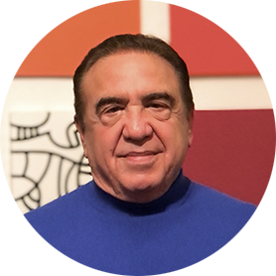
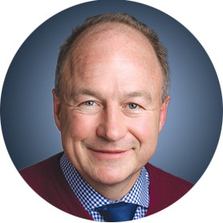
Faculty
Ajay K Nooka, MD, MPH
Professor, Department of Hematology
and Medical Oncology
Director, Myeloma Program
Associate Director of Clinical Research
Winship Cancer Institute
Emory University School of Medicine
Atlanta, Georgia
MODERATOR
Neil Love, MD Research To Practice Miami, Florida
Paul G Richardson, MD
Clinical Program Leader and Director of Clinical Research
Jerome Lipper Multiple Myeloma Center
Dana-Farber Cancer Institute
RJ Corman Professor of Medicine
Harvard Medical School
Boston, Massachusetts

Slide 3
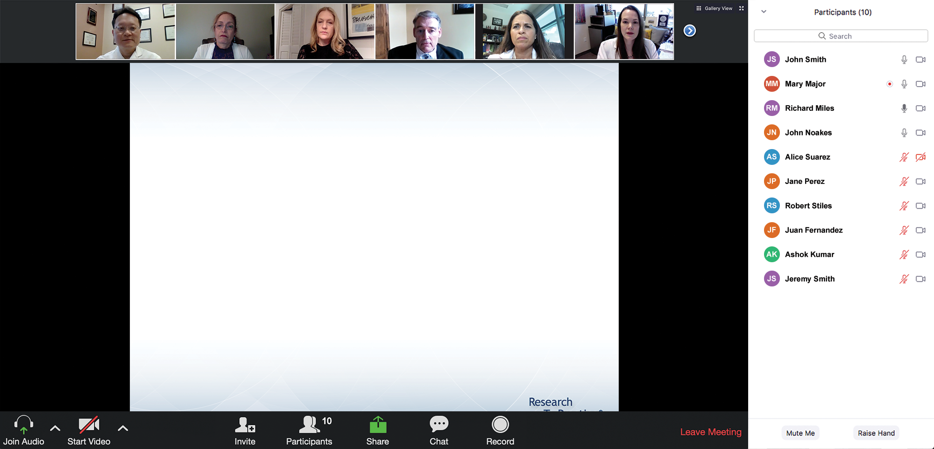
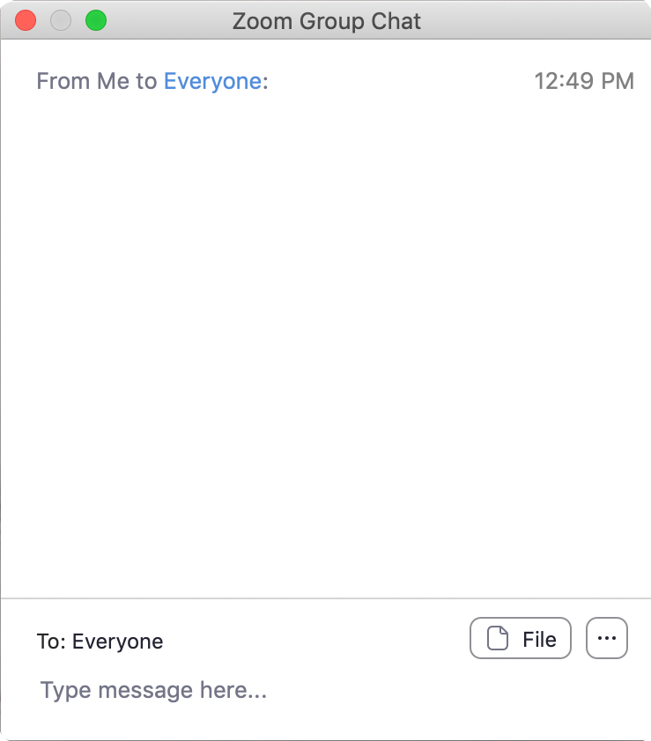
We Encourage Clinicians in Practice to Submit Questions
Feel free to submit questions now before the program begins and throughout the program.

Slide 4
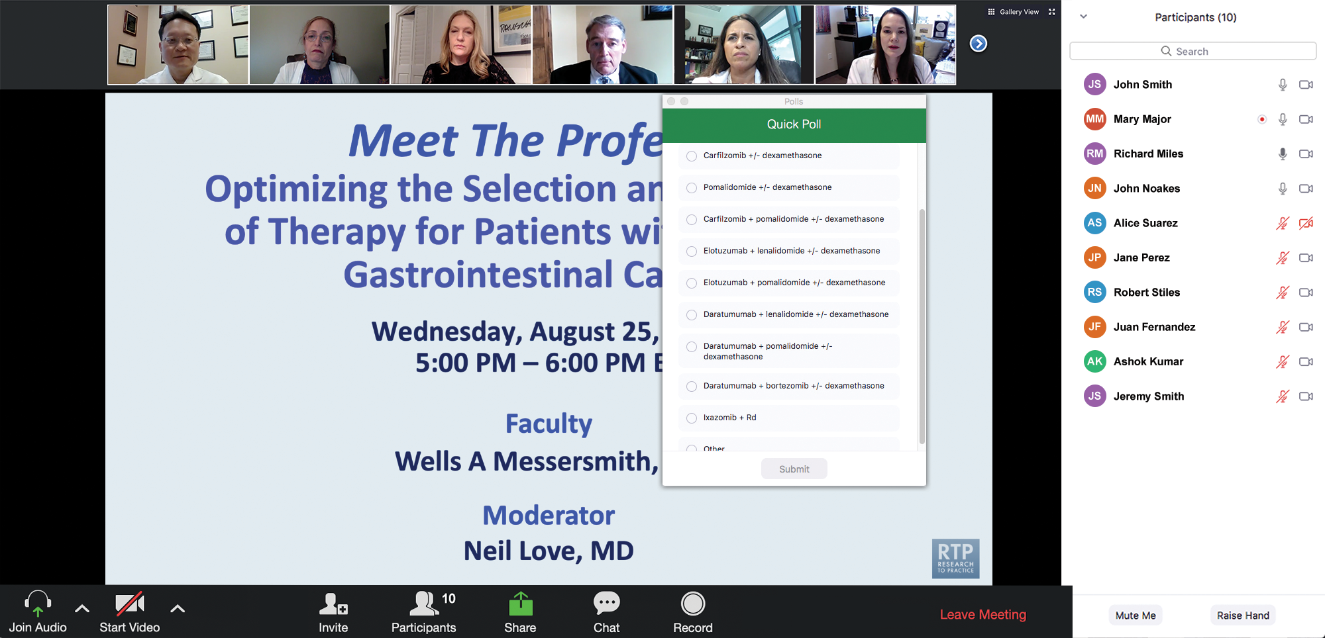
Clinicians in the Audience, Please Complete the Pre- and Postmeeting Surveys
Quick Survey
Quick Poll

Slide 5
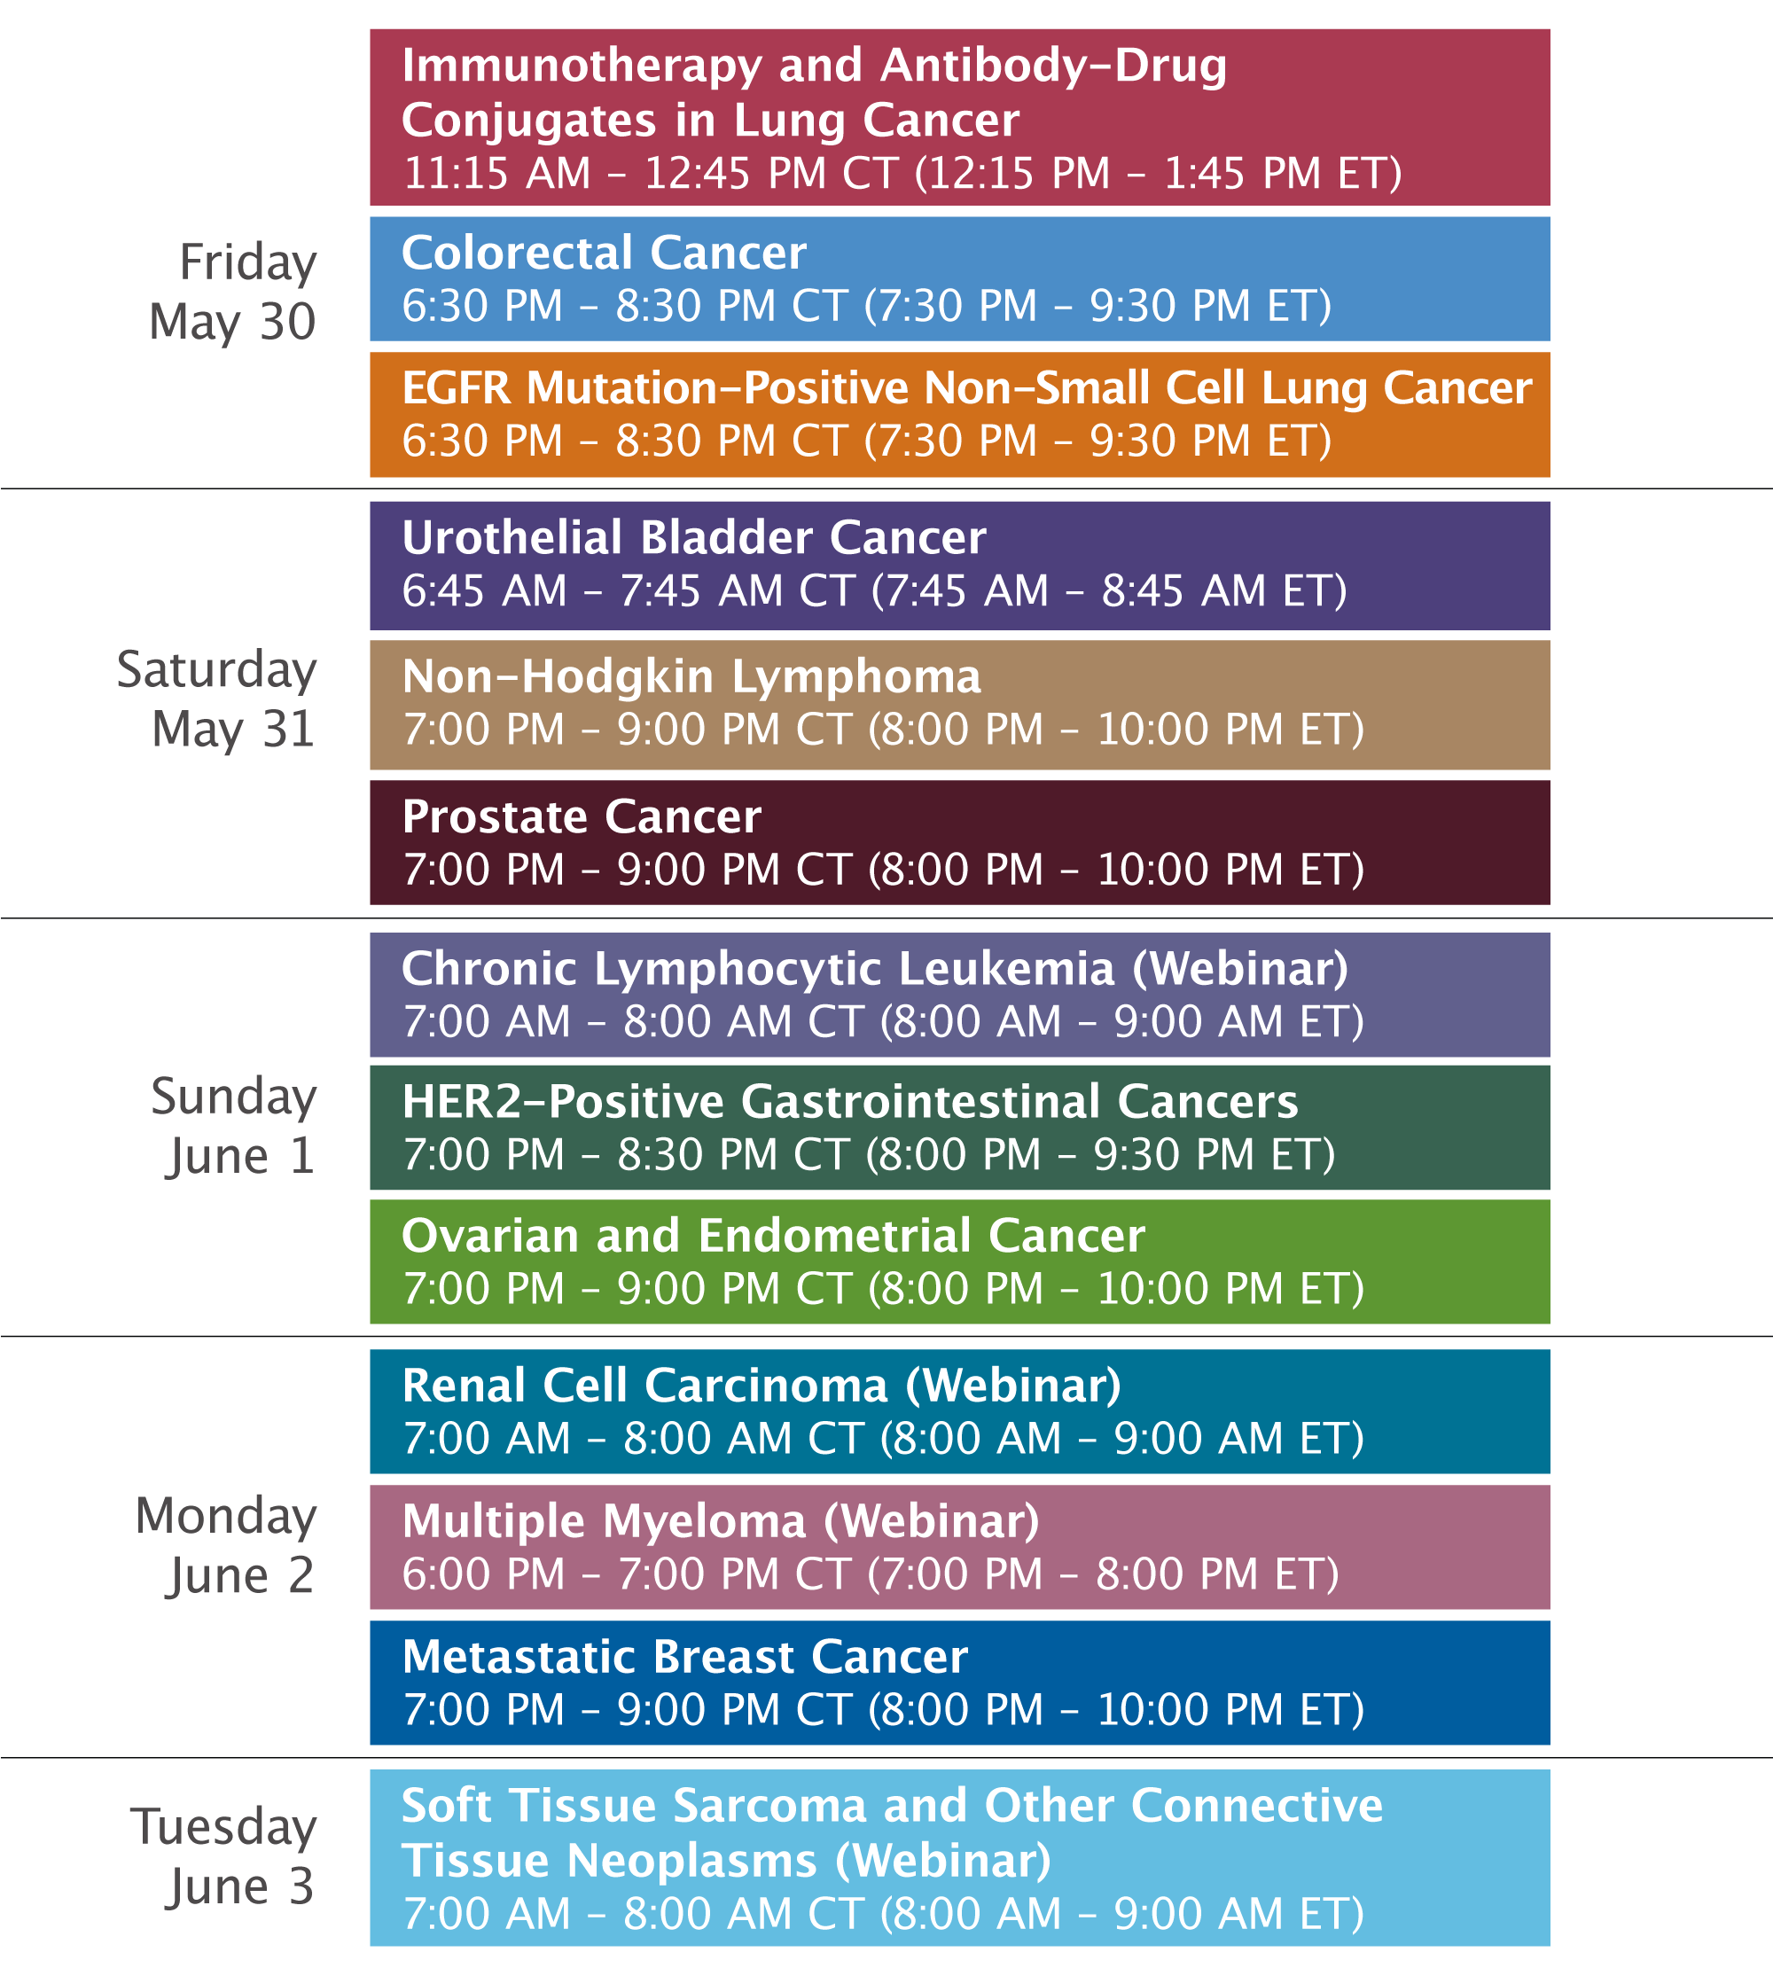

Slide 6
Consensus or Controversy? Clinical Investigators Provide Perspectives on the Current and Future Clinical Care of Patients with Metastatic Breast Cancer
Monday, June 2, 2025 7:00 PM – 9:00 PM CT (8:00 PM – 10:00 PM ET)
Faculty
Harold J Burstein, MD, PhD
Javier Cortés, MD, PhD
Rebecca A Dent, MD, MSc
Kevin Kalinsky, MD, MS
Joyce O’Shaughnessy, MD
Moderator
Hope S Rugo, MD

Slide 7
RTP Live from Chicago: Investigator Perspectives on Available Research Findings and Challenging Questions in the Management of Soft Tissue Sarcoma and Other Connective Tissue Disorders
Tuesday​, June 3, 2025 7:00 AM – 8:00 AM CT (8:00 AM – 9:00 AM ET)
Faculty
Rashmi Chugh, MD
Mrinal Gounder, MD
Moderator
Neil Love, MD

Slide 8
Questions from the Community: Investigators Discuss Available Research Guiding the Care of Patients with Relapsed/Refractory Multiple Myeloma
Monday​, June 2, 2025 6:00 PM – 7:00 PM CT (7:00 PM – 8:00 PM ET)
Faculty
Ajay K Nooka, MD, MPH
Paul G Richardson, MD
Moderator
Neil Love, MD

Slide 9
Dr Nooka — Disclosures Faculty
Advisory Boards and Consulting Agreements (Honoraria) | Adaptive Biotechnologies Corporation, AstraZeneca Pharmaceuticals LP, Cellectar Biosciences Inc, GSK, Janssen Biotech Inc, K36 Therapeutics, Kite, A Gilead Company, ONK Therapeutics, Opna Bio, Pfizer Inc, Sanofi, Sebia
Data and Safety Monitoring Boards/Committees | Janssen Biotech Inc
Grant/Research Support (for Investigator-Initiated Studies) | Amgen Inc, GSK, Janssen Biotech Inc, Merck, Takeda Pharmaceuticals USA Inc
Grant/Research Support (to University) | Amgen Inc, Arch Oncology, Bristol Myers Squibb, Cellectis, Chinook Therapeutics, Genentech, a member of the Roche Group, GSK, Janssen Biotech Inc, Karyopharm Therapeutics, Kite, A Gilead Company, Merck, Opna Bio, Pfizer Inc, Takeda Pharmaceuticals USA Inc

Slide 10
Dr Richardson — Disclosures Faculty
Consulting Agreements | Bristol Myers Squibb, Celgene Corporation, GSK, Karyopharm Therapeutics, Oncopeptides, Regeneron Pharmaceuticals Inc, Sanofi
Contracted Research | Oncopeptides

Slide 11
Dr Love — Disclosures
Dr Love is president and CEO of Research To Practice. Research To Practice receives funds in the form of educational grants to develop CME activities from the following companies: Aadi Bioscience, AbbVie Inc, ADC Therapeutics, Alexion Pharmaceuticals, Amgen Inc, Array BioPharma Inc, a subsidiary of Pfizer Inc, Arvinas, Astellas, AstraZeneca Pharmaceuticals LP, Aveo Pharmaceuticals, Bayer HealthCare Pharmaceuticals, BeiGene Ltd, Black Diamond Therapeutics Inc, Blueprint Medicines, Boehringer Ingelheim Pharmaceuticals Inc, Bristol Myers Squibb, Clovis Oncology, Coherus BioSciences, CTI BioPharma, a Sobi Company, Daiichi Sankyo Inc, Eisai Inc, Elevation Oncology Inc, Exact Sciences Corporation, Exelixis Inc, Genentech, a member of the Roche Group, Genmab US Inc, Geron Corporation, Gilead Sciences Inc, GSK, Hologic Inc, ImmunoGen Inc, Incyte Corporation, Ipsen Biopharmaceuticals Inc, Jazz Pharmaceuticals Inc, Johnson & Johnson, Karyopharm Therapeutics, Kite, A Gilead Company, Kura Oncology, Legend Biotech, Lilly, MEI Pharma Inc, Merck, Mersana Therapeutics Inc, Mirati Therapeutics Inc, Mural Oncology Inc, Natera Inc, Novartis, Novartis Pharmaceuticals Corporation on behalf of Advanced Accelerator Applications, Novocure Inc, Nuvalent, Pfizer Inc, Pharmacyclics LLC, an AbbVie Company, Puma Biotechnology Inc, Regeneron Pharmaceuticals Inc, Rigel Pharmaceuticals Inc, R-Pharm US, Sanofi, Seagen Inc, Servier Pharmaceuticals LLC, SpringWorks Therapeutics Inc, Stemline Therapeutics Inc, Syndax Pharmaceuticals, Taiho Oncology Inc, Takeda Pharmaceuticals USA Inc, TerSera Therapeutics LLC, and Tesaro, A GSK Company.

Slide 12
Commercial Support
This activity is supported by an educational grant from GSK.
Research To Practice CME Planning Committee Members, Staff and Reviewers
Planners, scientific staff and independent reviewers for Research To Practice have no relevant conflicts of interest to disclose.

Slide 13
This educational activity contains discussion of non-FDA-approved uses of agents and regimens. Please refer to official prescribing information for each product for approved indications.

Slide 14
Agenda
Introduction: ASCO 2025 Showstoppers
Module 1: Up-Front Treatment of Multiple Myeloma (MM) – Survey Questions
Module 2: Emerging Novel Therapies for Relapsed/Refractory (R/R) MM – Faculty Presentation
Module 3: Emerging Novel Therapies for R/R MM – Survey Questions
Module 4: Current Management of R/R MM – Faculty Presentation
Module 5: Current Management of R/R MM – Survey Questions
Module 6: ASCO and EHA 2025

Slide 15
Agenda
Introduction: ASCO 2025 Showstoppers
Module 1: Up-Front Treatment of Multiple Myeloma (MM) – Survey Questions
Module 2: Emerging Novel Therapies for Relapsed/Refractory (R/R) MM – Faculty Presentation
Module 3: Emerging Novel Therapies for R/R MM – Survey Questions
Module 4: Current Management of R/R MM – Faculty Presentation
Module 5: Current Management of R/R MM – Survey Questions
Module 6: ASCO and EHA 2025

Slide 16
Randomized Trial of Standard Chemotherapy Alone or Combined with Atezolizumab as Adjuvant Therapy for Patients with Stage III Deficient DNA Mismatch Repair (dMMR) Colon Cancer (Alliance A021502; ATOMIC)
Sinicrope F et al.
ASCO 2025;Abstract LBA1.
Three-year DFS was 86.4 % in the atezolizumab/mFOLFOX6 arm and 76.6 % in the mFOLFOX6 arm (HR, 0.50; 95% CI, 0.35–0.72).

Slide 17
Camizestrant + CDK4/6 Inhibitor (CDK4/6i) for the Treatment of Emergent ESR1 Mutations During First-Line (1L) Endocrine-Based Therapy (ET) and Ahead of Disease Progression in Patients (pts) with HR+/HER2– Advanced Breast Cancer (ABC): Phase 3, Double-Blind ctDNA-Guided SERENA-6 Trial
Turner N et al.
ASCO 2025;Abstract LBA4.
Hazard ratio for PFS was 0.44 (95% CI 0.31–0.60, p<0.00001; median PFS 16.0 vs 9.2 months).
PFS rate at 24 months was 29.7% vs 5.4%.

Slide 18
Trastuzumab Deruxtecan (T-DXd) + Pertuzumab (P) vs Taxane + Trastuzumab + Pertuzumab (THP) for First-Line (1L) Treatment of Patients (pts) with Human Epidermal Growth Factor Receptor 2-Positive (HER2+) Advanced/Metastatic Breast Cancer (a/mBC): Interim Results from DESTINY-Breast09
Tolaney S et al.
ASCO 2025;Abstract LBA1008.
T-DXd + P significantly improved PFS by BICR (hazard ratio 0.56; 95% CI 0.44, 0.71; P < 0.00001).
ILD occurred in 12.1% of 383 patients (predominantly Grade 1/2) who received T-DXd + P. Grade 5 ILD occurred in 2 patients.

Slide 19
Agenda
Introduction: ASCO 2025 Showstoppers
Module 1: Up-Front Treatment of Multiple Myeloma (MM) – Survey Questions
Module 2: Emerging Novel Therapies for Relapsed/Refractory (R/R) MM – Faculty Presentation
Module 3: Emerging Novel Therapies for R/R MM – Survey Questions
Module 4: Current Management of R/R MM – Faculty Presentation
Module 5: Current Management of R/R MM – Survey Questions
Module 6: ASCO and EHA 2025

Slide 20
Survey of 50 Community-Based General Medical Oncologists
May 14-24, 2025

Slide 21
Questions from General Medical Oncologists — First-Line Treatment of MM
Myeloma is so complicated now.

Slide 22
Questions from General Medical Oncologists — First-Line Treatment of MM; Smoldering Myeloma
The juice has to be worth the squeeze — there are so many options already, for MM to stand out there has to be a definite advantage in PFS, OS, or tox
Should all patients get an anti-CD38 and which one?
I basically never use isatuximab. Much less chair time with subcutaneous dara
In what situations (reimbursement aside) would you recommend daratumumab for smoldering myeloma — what dose and for how long?

Slide 23
Agenda
Introduction: ASCO 2025 Showstoppers
Module 1: Up-Front Treatment of Multiple Myeloma (MM) – Survey Questions
Module 2: Emerging Novel Therapies for Relapsed/Refractory (R/R) MM – Faculty Presentation
Module 3: Emerging Novel Therapies for R/R MM – Survey Questions
Module 4: Current Management of R/R MM – Faculty Presentation
Module 5: Current Management of R/R MM – Survey Questions
Module 6: ASCO and EHA 2025

Slide 24
Emerging Novel Therapies for Relapsed/Refractory (R/R) MM, With A Focus On Belantamab Mafodotin and the CELMoDs
Paul G. Richardson, MD
RJ Corman Professor of Medicine
Harvard Medical School
Clinical Program Leader, Director of Clinical Research
Jerome Lipper Multiple Myeloma Center
Dana-Farber Cancer Institute
Boston, Massachusetts

Slide 25
Treatment of MM in 2025: multiple therapies approved or under investigation
Backbone/standard-of-care agents
Recent approvals / later relapse
Emerging therapies for MM**
IMiDs
PIs
mAbs
HDACis
ADCs
Targeted therapies
CAR T cell therapies
BiTEs® / bispecifics
BiTEs® / bispecifics
CELMoDs®
Lenalidomide
Bortezomib*
Daratumumab (CD38)
Panobinostat‡
Belantamab mafodotin‡
Selinexor
Idecabtagene vicleucel
Teclistamab (BCMAxCD3)
ABBV-383† (BCMAxCD3)
Iberdomide†
Pomalidomide
Carfilzomib
Isatuximab (CD38)
Vorinostat†,#
AZD0305†
Melflufen‡
Ciltacabtagene autoleucel
Elranatamab (BCMAxCD3)
Alnuctamab†# (BCMAxCD3)
Mezigdomide†
Thalidomide
Ixazomib
Elotuzumab (SLAMF7)
Belantamab†
Venetoclax†,#
CAR T cell therapies
Talquetamab (GPRC5DxCD3)
Linvoseltamab† (BCMAxCD3)
Others
Marizomib†,#
Strategies for managing MM, including doublet, triplet, and quadruplet combination regimens both upfront and in relapse, as well as treatment sequencing, are rapidly evolving in the context of this expanding therapeutic armamentarium
Lisaftoclax†
Arlocabtagene autoleucel†
Forimtamig† (GPRC5DxCD3)
Cemsidomide, Inobrodib†
*Also approved in combination with liposomal doxorubicin (Doxil®). **Under investigation. †Not currently approved in RRMM. ‡FDA approval withdrawn. #Development deprioritized.
ADCs, antibody–drug conjugates; BCMA, B-cell maturation antigen; BiTEs®, bispecific T-cell engagers; CAR, chimeric antigen receptor; CELMoDs®, cereblon E3 ligase modulators; CHMP, Committee for Medicinal Products for Human Use; COMy, Controversies in multiple myeloma; EMA, European Medicines Agency; FcRH5, Fc receptor-homolog 5; FDA, Food and Drug Administration; GPRC5D, G protein-coupled receptor family C group 5 member D; ICIs, immune checkpoint inhibitors; IMiDs®, immunomodulatory drugs; mAbs, monoclonal antibodies; PIs, proteasome inhibitors; RRMM, relapsed/refractory multiple myeloma.
Sonrotoclax†
Anitocabtagene autoleucel†
Cevostamab† (FcRH5xCD3)
CAR NK cell therapies†
Durcabtagene autoleucel†
ICIs, Immuno-cytokines†,#
Adapted from Richardson PG. 5th Oxford Myeloma Workshop, January 30–31, 2025, Oxford, UK.

Slide 26
BCMA-targeted antibody–drug conjugate (ADC) therapy for RRMM Ongoing development of belantamab mafodotin^{1,2}
First ADC approved in RRMM (2020)
US and EU marketing authorisation withdrawn following DREAMM-3 not meeting its primary endpoint^{3,4}
Remains under investigation in combination regimens in multiple studies, with positive results from the DREAMM-7⁵ and DREAMM-8⁶ phase 3 trials in RRMM
Humanized IgG1 Fc-engineered ADC comprising a BCMA-targeted antibody covalently linked via a cysteine linker to the microtubule inhibitor monomethyl auristatin F (MMAF)
1. Trudel S, et al. Lancet Oncol 2018;19(12):1641–53. 2. Richardson PG, et al. Blood Cancer J 2020;10(10):106. 3. Dimopoulos MA, et al. Lancet Haematol 2023;10(10):e801–12. 4. Mukhopadhyay P, et al. Blood Cancer J 2025;15(1):15. 5. Hungria V, et al. N Engl J Med 2024;391(5):393–407. 6. Dimopoulos MA, et al. N Engl J Med 2024;391(5):408–21. Left-hand figure adapted from Tai YT, Anderson KC. Immunotherapy 2015;7(11):1187–99. Right-hand figure adapted from Cho S-F, et al. Front Immunol 2018;9:1821.

Slide 27
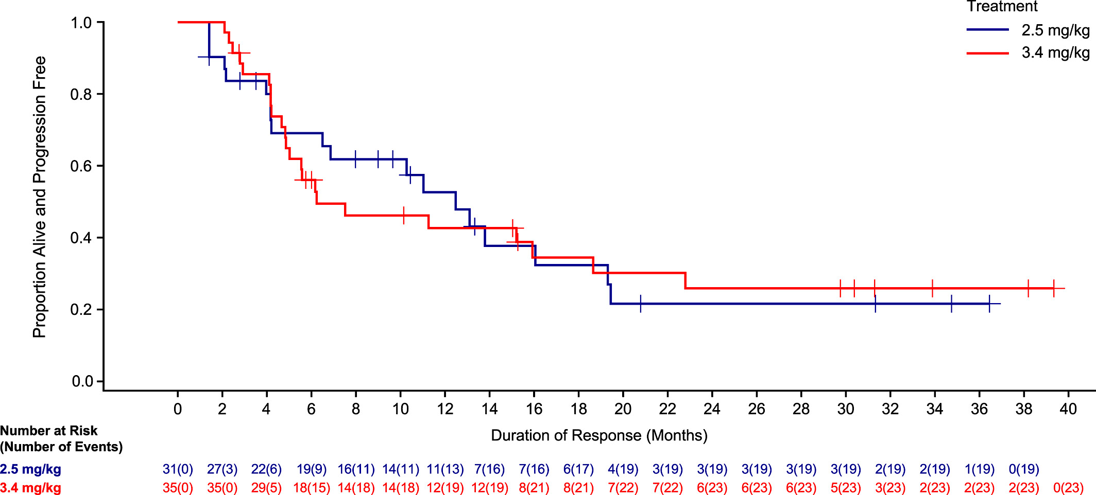
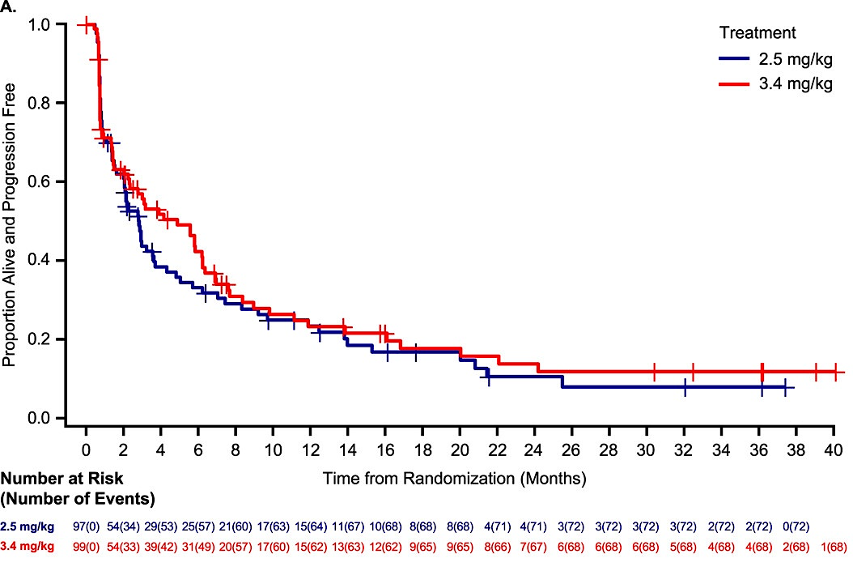
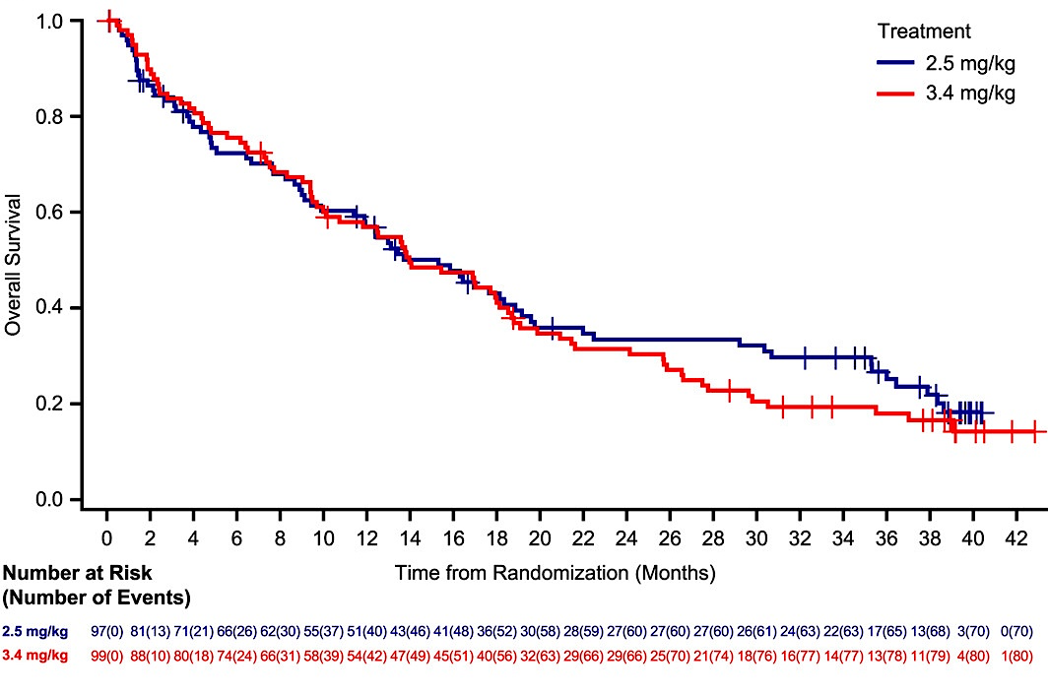
Belantamab mafodotin: initial approval based on DREAMM-2 in heavily pretreated RRMM
ORR 32%
≥VGPR 19%
CBR 36%
ORR 35%
≥VGPR 24%
CBR 40%
 | 2.5 mg/kg (n=97) | 3.4 mg/kg (n=99)
Median DOR, months | 12.5 | 6.2
Patients
N=97 and N=99 in 2.5 and 3.4 mg/kg cohorts
Median age: 65 and 67 years
High-risk cytogenetics: 42% and 47%
Median prior lines of therapy: 7 and 6
90% and 89% lenalidomide-refractory
87% and 78% pomalidomide-refractory
76% and 75% bortezomib-refractory
100% and 92% daratumumab-refractory
100% and 100% triple-class-refractory
 | 2.5 mg/kg (n=97) | 3.4 mg/kg (n=99)
Median PFS, months | 2.8 | 3.9
 | 2.5 mg/kg (n=97) | 3.4 mg/kg (n=99)
Median OS, months | 15.3 | 14.0
Safety (2.5 and 3.4 mg/kg cohorts)
Keratopathy: 71% and 75%
Grade 3/4 keratopathy: 31% and 25%
Any Grade 3/4 AE: 84% and 83%
Grade 3/4 thrombocytopenia: 22% and 32%; anemia 21% and 28%; neutropenia 11% and 16%
Infections: 45% and 55%
Grade ≥3 infections: 20% and 44%
Discontinuations: 12% and 12%
Lonial S, et al. Lancet Oncol 2020;21(2):207–21. Lonial S, et al. Cancer 2021;127(22):4198–212. Nooka A, et al. Cancer 2023;129(23):3746–60. Figures reproduced under Creative Commons CC BY-NC 4.0 license.

Slide 28
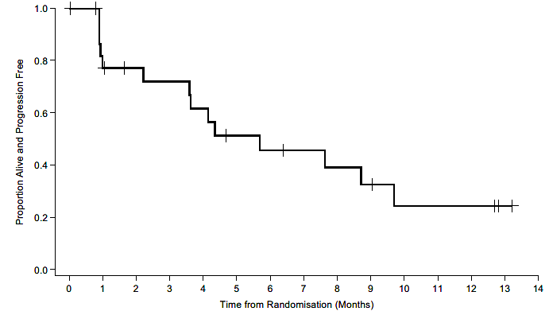
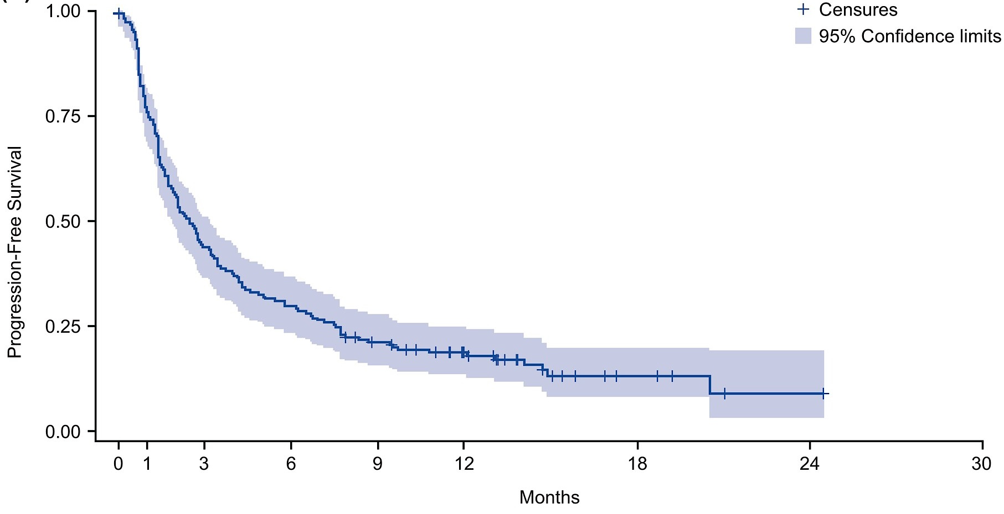
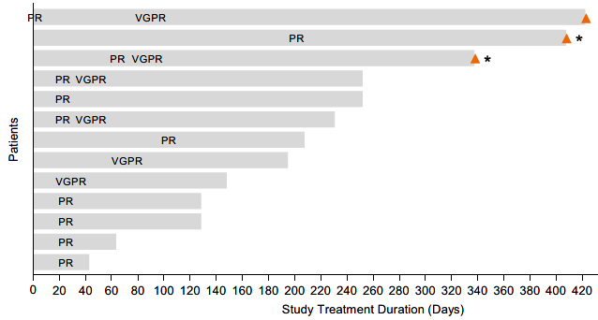
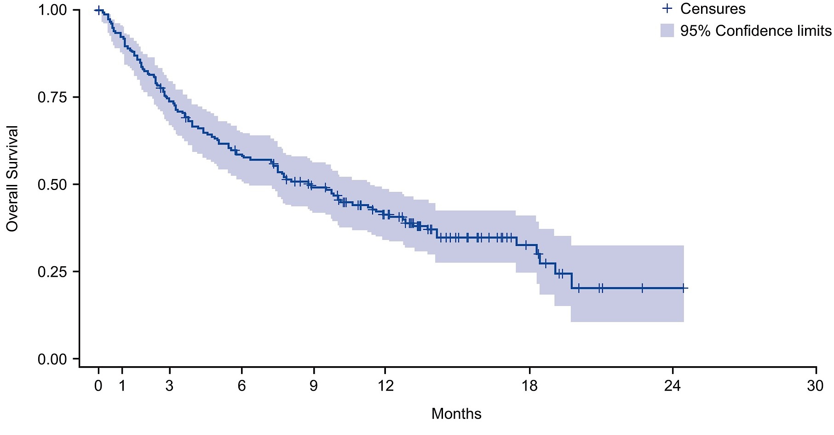
DREAMM-2: belantamab mafodotin lyophilised presentation cohort
Patients, N=25
Median PFS 5.7 months
Median OS 24.5 months
(median follow-up 24.5 months)
ALFA: Real-world study of belantamab mafodotin in RRMM
Median age: 68 years, 24% aged ≥75 years
ISS III: 40%; EMD: 24%
High-risk cytogenetics: 28% (20% del17p; 20% 1q21+)
Median prior lines of therapy: 5
100% triple-class refractory
Non-interventional, retrospective study of 184 patients; median age 70 years
32.5% high-risk cytogenetics
Median 5 prior therapies; 97% prior R, 98% prior V, 89% prior Dara, 79% penta-exposed
Median follow-up 7.8 months
ORR 33%, including 20% ≥VGPR
CBR 36%
Ophthalmologic AEs (grade 3/4): any 56% (29%), keratopathy/keratitis 42% (8%), decreased visual acuity 11% (1%), other ocular disorders 13% (2%), resulting in discontinuation 12.5%
Roussel M, et al. Eur J Haematol 2024; 113(3):310–20. Figures reproduced under Creative Commons CC BY-NC 4.0 license
Median PFS 2.4 months
Safety
Median OS 8.8 months
Keratopathy in 96% (21% grade 3, no grade 4)
Other ocular toxicity: blurred vision 42%, dry eye 25%, intraocular pressure increased 21%
BCVA declined to 20/50 at least once in 33%
Grade 3/4 thrombocytopenia in 21%, anemia in 21%, and neutropenia in 8%
Dose reductions in 58%, due to keratopathy (MECs) in 50% (1 patient discontinued due to keratopathy)
ORR 52% (VGPR 24%)
Median time to response 0.9 months
Median DOR 9.0 months
Richardson PG, et al. Blood Cancer J 2020;10(10):106. Figures reproduced under Creative Commons CC BY 4.0 license. Nooka A, et al. Cancer 2023;129(23):3746–60.

Slide 29
DREAMM-3: Belantamab mafodotin vs Pom-dex as 3rd-line therapy¹
Patients (N=325)
218 received belamaf 2.5 mg/kg Q3W vs 107 Pom-dex
Exposure
Median belamaf exposure 4.1 (range 0.4–22.9) months
Median age 68 years
54% vs 62% male
24% vs 26% ISS stage III
Median 4 vs 3 prior lines
40% vs 38% prior dara
Median Pom-dex exposure 5.3 (range 0.4–24.0) months
Outcomes
Median follow-up: 11.5 vs 10.8 months
Median PFS: 11.2 vs 7.0 months (HR 1.03, stratified Cox model, not significant)
MRD-neg ≥VGPR 7% vs 0
1-year DOR 77% vs 48%
Median PFS2 18.7 vs 12.7 months
Median OS 21.2 vs 21.1 months
Safety
AEs 97% vs 93%
Grade 3/4 AEs 76% vs 70%
Grade 5 AEs 7% vs 11%
SAEs 43% vs 39%
AEs leading to discontinuation 15% vs 17%
Consistent safety profile in 50 patients receiving belamaf for ≥52 weeks²
ORR 36%
ORR 41%
1. Dimopoulos MA, et al. Lancet Haematol 2023;10(10):e801–12. 2. Hungria VTM, et al. Blood 2023;142(suppl 1):abstract 3357.

Slide 30
DREAMM-6: Belantamab mafodotin + Rd (Arm A)¹
Multiple belantamab mafodotin doses
45 patients enrolled
Outcomes
Median follow-up: 23.7 months
Median PFS 18.4 months
Cohort 1, ‘STRETCH’: 1.9 mg/kg Q8W – n=12
Cohort 2, ‘SINGLE’: 1.9 mg/kg Q4W – n=4
Cohort 3, ‘SINGLE’: 2.5 mg/kg Q4W – n=16
Cohort 4, ‘SPLIT’: 2.5 mg/kg D1/8 Q4W – n=13
Median age 68 years, 18% aged ≥75 years
31% high-risk cytogenetics
13% EMD
Median of 3 prior lines of therapy
58% R-exposed, 31% Dara-exposed
Safety
No clinically meaningful differences in safety profile across cohorts
Grade ≥3 AEs 87%: keratopathy 53%, neutrophil count decreased 22%, platelet count decreased 22%, visual acuity reduced 22%
Any ocular AEs 80% (Grade 3/4 69%)
SAEs 53%
ORR 75%
≥VGPR 50%
≥CR 25%
ORR 69%
≥VGPR 38%
≥CR 15%
ORR 67%
≥VGPR 47%
≥CR 29%
ORR 69%
≥VGPR 46%
≥CR 44%
ORR 58%
≥VGPR 42%
≥CR 25%
Belantamab mafodotin 2.5 mg/kg SINGLE + Vd (Arm B)^{2,3}
N=18, median 3 prior lines, 89% V-exposed, 50% Dara-exposed
ORR 78% (50% VGPR); CBR 83%
Median DOR not reached
AEs leading to permanent discontinuation of any study treatment 28% (0% leading to discontinuation of belantamab mafodotin)
AEs leading to dose reductions 72%
Keratopathy 39%, thrombocytopenia 33%
AEs leading to dose interruptions 100%
Keratopathy 83%, thrombocytopenia 39%
1. Popat R, et al. Blood Cancer J 2024;14(1):184. 2. Nooka A, et al. J Clin Oncol 2020;38(15_suppl):abstract 8502. 3. Popat R, et al. Blood 2020;136(suppl 1):abstract 1419.

Slide 31
BCMA-targeted ADC for early-relapse RRMM DREAMM-7: Belantamab mafodotin + Vd vs Dara-Vd as ≥2nd-line therapy
 | BVd | DVd
Median PFS (95% CI), months | 36.6 (28.4-NR) | 13.4 (11.1-17.5)
HR (95% CI) | 0.41 (0.31-0.53), P<0.00001
Phase 3 DREAMM-7 study
Belamaf+Vd x 8 cycles, then belamaf Q3W, N=243
Dara-Vd x 8 cycles, then Dara Q4W, N=251
1.0
Updated analysis of OS in DREAMM-7 (median follow-up 39.4 months)
2024
0.8
Hungria V, et al. Blood 2024;144(supplement 1):772.
100
Patients | Belamaf-Vd, N=243 | Dara-Vd, N=251
Median age, years | 65 | 64
Age ≥75 years | 15% | 12%
High-risk cytogenetics | 28% | 27%
EMD | 5% | 10%
1 / 2-3 / ≥4 prior lines | 51 / 36 / 12% | 50 / 39 / 11%
Prior PI | 90% | 86%
Prior IMiD | 81% | 86%
R-refractory | 33% | 35%
Prior Dara | 1% | 2%
Prior ASCT | 67% | 69%
0.6
69%
79%
80
Probability of PFS
74%
0.4
43%
60
Patients alive, %
67%
0.2
BVd
40
60%
OS | BVd (n = 243) | DVd (n = 251)
Events, n (%) | 68 (28) | 103 (41)
HR (95% CI) | 0.58 (0.43-0.79) P = .00023
DVd
0.0
20
0
3
6
9
12
15
18
21
24
27
30
33
36
39
Time since randomization (months)
0
Outcomes
Significant PFS benefit – seen across prespecified subgroups, including R-refractory patients (HR 0.37), patients with high-risk cytogenetics (HR 0.36), and patients with prior V (HR 0.45)
Early OS trend favoring belamaf-Vd – 18-month OS 84% vs 73% (HR 0.57)
0
4
8
12
16
20
24
28
32
36
40
44
48
52
Time from randomization, months
Hungria V, et al. N Engl J Med 2024;391(5):393–407.

Slide 32
BCMA-targeted ADC for early-relapse RRMM DREAMM-7: Belantamab mafodotin + Vd vs Dara-Vd as ≥2nd-line therapy
2024
ORR 83.1%
≥VGPR 66.3%
≥CR 35.8%
Safety | Belamaf-Vd, N=243 | Dara-Vd, N=251
Grade 3-4 AE | 95% | 78%
Related | 92% | 67%
Discontinuation due to AEs | 32% | 19%
SAEs | 53% | 38%
Death due to AEs | 11% | 8%
Grade ≥3 hematologic AEs
Thrombocytopenia | 56% | 35%
Neutropenia | 14% | 10%
Anemia | 9% | 10%
Infections | 73% | 68%
Grade ≥3 | 33% | 20%
Pneumonia | 12% | 4%
Ocular AEs (Grade ≥3) | 79% (34%) | 29% (3%)
Vision blurred | 68% (24%) | 11% (<1%)
Dry eye | 51% (7%) | 7% (0)
Photophobia | 47% (2%) | 2% (0)
Eye irritation | 43% (5%) | 5% (0)
ORR 71.3%
≥VGPR 46.2%
≥CR 17.5%
MRD-neg
38.7%
Outcomes in patients with high-risk cytogenetics (HRC)
PFS in patients by MRD status
2024
Patients achieving CR MRD-neg status
Median PFS and OS not reached in either arm
10% and 21% of patients in the Belamaf-Vd and Dara-Vd arms, respectively, had PFS events
5% and 4% had OS events
Patients not achieving CR MRD-neg status
Median PFS 25.0 vs 11.8 months
18-month OS rate 79% vs 70%
Hungria V, et al. Blood 2024;144(supplement 1):3359.
50% vs 46% had HRC
17% vs 17% t(4;14); 3% vs 2% t(14;16)
12% vs 14% del17p
39% vs 31% amp1q
With belantamab mafodotin + Vd vs Dara-Vd in patients with ≥1 HRC
Median PFS 33.2 vs 11.1 months
18-month PFS 61% vs 38%
ORR 81% vs 69% (≥CR 39% vs 17%)
Mateos M-V, et al. J Clin Oncol 2025;43(16_supplement):7546.
MRD-neg
17.1%
Phase 1 study of Bela-RVd in RRMM with 1–3 prior lines
2024
19 patients; median age 63 years
53% high-risk cytogenetics
42% R-refractory, 11% V-refractory, 26% Dara-refractory
Median follow-up 16.1 months
ORR 100%, including 74% ≥VGPR and 53% ≥CR
MRD-neg 53% (10⁻⁵) / 37% (10⁻⁶)
Common AEs (grade ≥3): eye disorders 95% (32%), blurred vision 90% (37%), fatigue 58% (0%), hypokalemia 53% (11%)
Atrash S, et al. Blood 2024;144(supplement 1):4751.
Median DOR 40.8 vs 17.8 months
Median PFS2 NR vs 33.4 months (HR 0.59)
Hungria V, et al. N Engl J Med 2024;391(5):393–407. Hungria V, et al. Blood 2024;144(supplement 1):772.

Slide 33
BCMA-targeted ADC for early-relapse RRMM DREAMM-8: Belantamab mafodotin + Pom-dex vs Pom-Vd as ≥2nd-line therapy
 | BPd | Pom-Vd
Median PFS (95% CI), months | NR (20.6-NR) | 12.7 (9.1-18.5)
HR (95% CI) | 0.52 (0.37-0.73), P<0.001
Phase 3 DREAMM-8 study
Belamaf-Pom-dex until PD/death, N=155
Pom-Vd until PD/death, N=147
Patients with ≥1 prior line, including lenalidomide
1.0
0.8
71%
0.6
Patients | Belamaf-Pom-dex, N=155 | Pom-Vd, N=147
Median age, years | 67 | 68
Age ≥75 years | 12% | 24%
High-risk cytogenetics | 34% | 32%
EMD | 13% | 7%
1 / 2 or 3 / ≥4 prior lines | 53 / 35 / 12% | 52 / 33 / 15%
Prior PI | 90% | 93%
Prior IMiD | 100% | 100%
IMiD-refractory | 82% | 76%
Prior CD38 mAb | 25% | 29%
CD38 mAb-refractory | 23% | 24%
Prior ASCT | 64% | 56%
Probability of PFS
0.4
51%
0.2
Belamaf-Pom-dex
Pom-Vd
0.0
0
3
6
9
12
15
18
21
24
27
30
33
36
39
Time since randomization (months)
Outcomes
Significant PFS benefit – seen across prespecified subgroups, including R-refractory patients (HR 0.45), CD38 mAb-refractory patients (HR 0.65), and patients with high-risk cytogenetics (HR 0.57)
Early OS trend favoring belamaf-Pom-dex – 12-month OS 83% vs 76% (HR 0.77)
Dimopoulos MA, et al. N Engl J Med 2024;391(5):408–421.

Slide 34
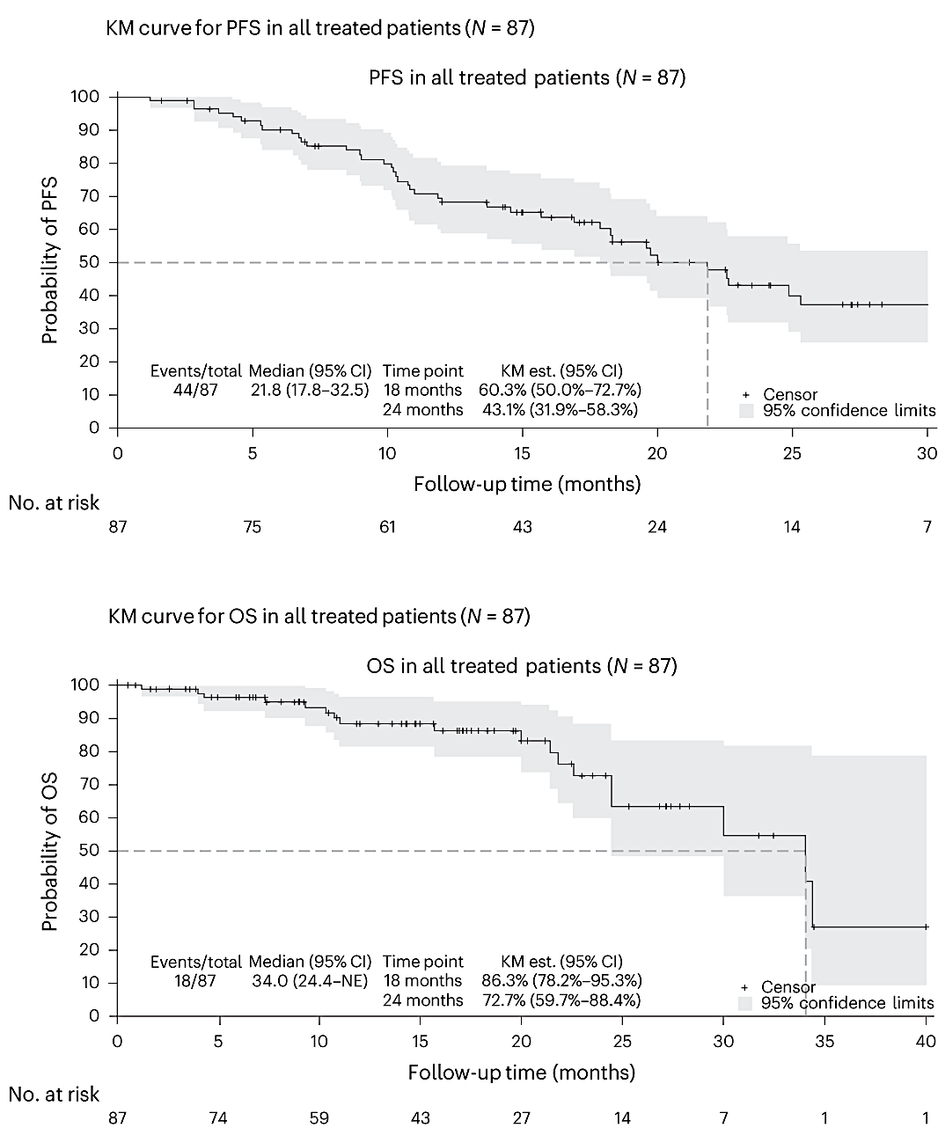
BCMA-targeted ADC for early-relapse RRMM DREAMM-8: Belantamab mafodotin + Pom-dex vs Pom-Vd as ≥2nd-line therapy
ORR 77%
≥VGPR 64%
≥CR 40%
Safety | Belamaf-Pom-dex, N=155 | Pom-Vd, N=147
Grade ≥3 AE | 94% | 76%
Related | 80% | 59%
Discontinuation due to AEs | 15% | 12%
SAEs | 63% | 45%
Death due to AEs | 11% | 11%
Grade ≥3 hematologic AEs
Thrombocytopenia | 24% | 20%
Neutropenia | 42% | 28%
Anemia | 10% | 13%
Infections | 82% | 68%
Grade ≥3 | 49% | 26%
Ocular AEs, ≥25% (Grade ≥3 AEs, ≥10%)
Blurred vision | 79% (17%) | 15% (0)
Dry eye | 61% (8%) | 10% (0)
Foreign body sensation in eye | 61% (6%) | 6% (0)
Eye irritation | 50% (4%) | 9% (0)
Photophobia | 44% (3%) | 4% (0)
Eye pain | 33% (2%) | 5% (0)
Cataract | 27% (6%) | 10% (4%)
Reduced visual acuity | 23% (13%) | 6% (1%)
ORR 72%
≥VGPR 38%
≥CR 16%
MRD-neg
32%
Outcomes in patients with high-risk cytogenetics (HRC)
Outcomes by MRD status
ALGONQUIN: Phase 1/2 study of Bela-Pom-dex in RRMM
44% vs 41% had HRC
15% vs 14% t(4;14); 5% vs 7% t(14;16)
21% vs 18% del17p
26% vs 22% amp1q
With belantamab mafodotin + Pom-dex vs Pom-Vd in patients with ≥1 HRC
Median PFS 21.1 vs 9.2 months
18-month PFS 53% vs 33%
ORR 76% vs 65% (≥CR 43% vs 15%)
Trudel S, et al. J Clin Oncol 2025;43(16_supplement):7533.
24% vs 5% had MRD-neg CR
In MRD-neg vs MRD-pos patients:
Overall PFS HR 0.14 (median NR vs 14.0 months)
OS HR 0.18 (18-month rate 93% vs 69%)
With belantamab mafodotin + Pom-dex vs Pom-Vd:
MRD-neg: median PFS NR vs NR
MRD-pos: median PFS 19.6 vs 10.2 months
MRD-neg: 18-month OS 92% vs 100%
MRD-neg: 18-month OS 72% vs 67%
Trudel S, et al. J Clin Oncol 2025;43(16_supplement):7533.
87 patients; median age 67 years
18% high-risk cytogenetics
Median 3 prior therapies; 97% R-refractory, 86% PI-refractory, 67% CD38 mAb-refractory; 55% triple-class-refractory
Median follow-up 14.5 months
ORR 88%, including 73% ≥VGPR and 33% ≥CR
Common AEs (grade 3/4): keratopathy 71% (55%), decreased visual acuity 78% (44%), fatigue 60% (12%), infection 51% (21%), neutropenia 49% (41%), thrombocytopenia 44% (33%)
Trudel S, et al. Nat Med 2024;30(2):543–51. Figures reproduced under Creative Commons CC BY 4.0 license
Median PFS 21.8 months
MRD-neg
5%
Median OS 34.0 months
12-month DOR 79% vs 61%
Dimopoulos MA, et al. N Engl J Med 2024;391(5):408–421.

Slide 35
AMaRC 19-02 BelaCarD study: Belantamab mafodotin + Kd in RRMM
2023
Treatment exposure
Phase 1/2 study
Median 9 cycles received
Belamaf + Kd in RRMM after 1-3 prior lines
N=65, median age 69.7 years
33% high-risk cytogenetics
25.5% / 38.2% / 34.6% with 1 / 2 / 3 prior lines
42% / 50% / 45% / 33% / 31% V-/ K- / R- / Pom- / CD38 mAb-refractory
DREAMM-20: Belantamab (naked BCMA mAb) in RRMM
Safety
18 patients with RRMM after ≥3 prior lines
Median age 76 years
17/18 triple-class exposed, 2/18 prior BCMA-targeted therapy
ORR 28% (2 VGPR, 3 PR)
Treatment-related AEs 67%
4 infusion-related reactions, 4 neutrophil count decreased, 2 anemia, 2 vision blurred, 2 platelet count decreased
No belantamab-related grade ≥2 corneal events
Quach H, et al. J Clin Oncol 2025;43(16_supplement):7550.
73% Grade 3/4 AEs
15% belamaf-related SAEs
9% discontinued due to AEs
Common all-grade (Grade 3/4 AEs):
Blurred vision 40% (7%)
Nausea/vomiting 29% (4%)
Insomnia 24% (11%)
Thrombocytopenia 24% (16%)
Ocular AEs 79%
BCVA decline 77% (68%)
Keratopathy 75% (47%)
Efficacy
By end of cycle 2, ORR 80%, ≥VGPR 40%
Median follow-up 13 months
24-month PFS 56.1%
Lasica M, et al. Blood 2023;142(suppl 1):abstract 2012.

Slide 36
Risk of ocular toxicity with belantamab mafodotin in RRMM
Risk of ocular events in DREAMM-7/DREAMM-8¹
Risk of ocular toxicity: systematic review and meta-analysis²
Analysis of risk
Baseline ocular conditions 62%
Cataract 50%
Keratopathy 14%
Dry eye 14%
Treatment-emergent ocular AEs
74% and 87% in patients with baseline ocular conditions
79% and 91% in patients without baseline ocular conditions
Baseline ocular conditions did not increase risk of ocular AEs
392 patients treated with belantamab mafodotin in DREAMM-7/DREAMM-8
In DREAMM-7 and DREAMM-8, respectively:
Analysis of 1102 patients from 3 phase 3 trials
Ocular toxicity, % | Belamaf | Comparator | Risk ratio
Any-grade ocular AE | 77% | 25% | 3.3
High-grade | 35% | 2% | 17.6
Dry eyes | 45% | 7% | 7.5
Blurred vision | 60% | 10% | 6.5
Photophobia | 37% | 3% | 15.6
Eye irritation | 37% | 5% | 7.6
Eye pain | 26% | 3% | 9.4
Foreign body eye sensation | 42% | 4% | 10.7
Cataract | 17% | 9% | 2.1
Clinical management of ocular toxicity
Presentation at EHA 2025
Clinical management of belantamab-mafodotin-associated ocular events: practical guidance from the Belamaf Expert Experience Program
Terpos E, et al. Abstract PS1752.
1. Quach H, et al. J Clin Oncol 2025;43(16_supplement):7544. 2. Hattin R, et al. J Clin Oncol 2025;43(16_supplement):12040.

Slide 37
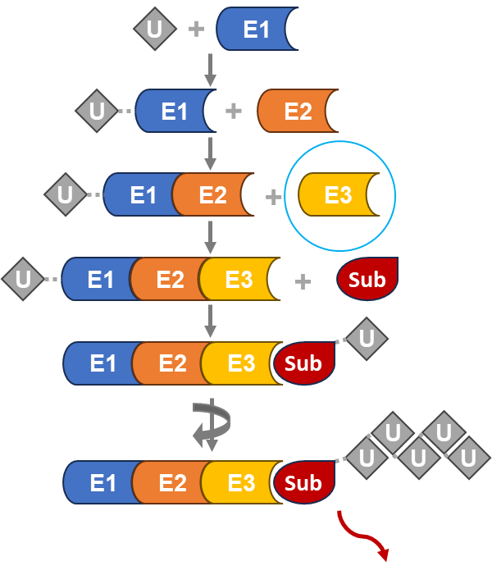
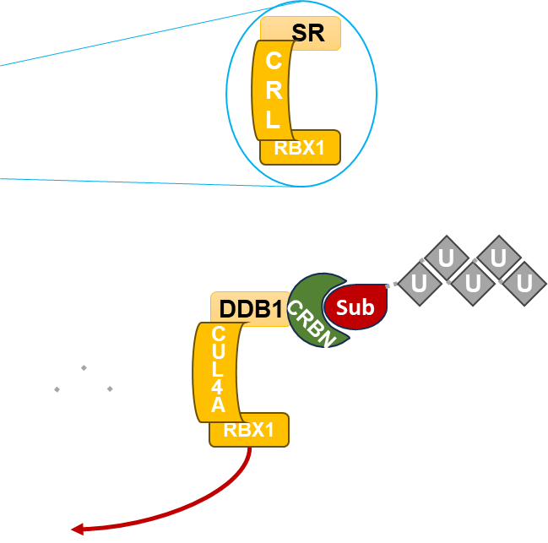
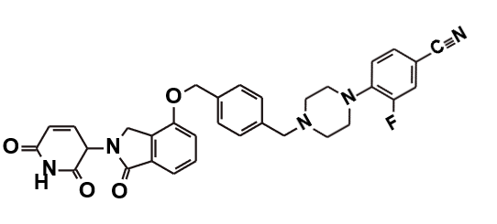
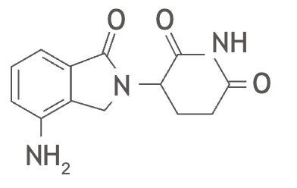
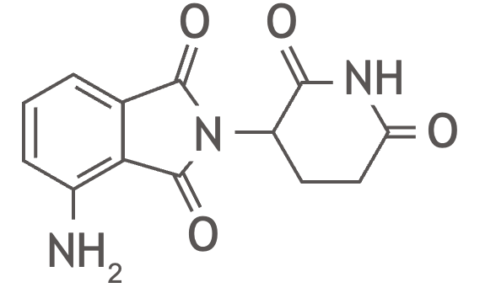
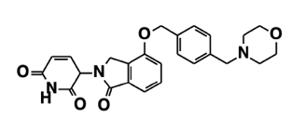
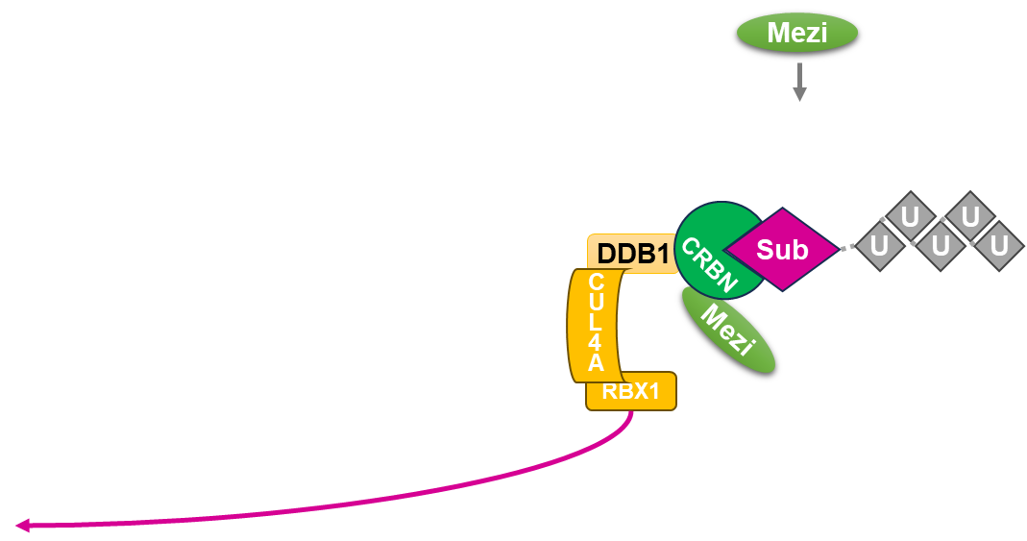
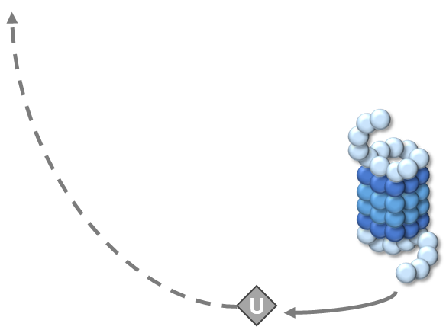
CELMoDs ~ targeting cereblon: novel immunomodulators and protein degraders for RRMM
1. The ubiquitin–proteasome system (UPS) tags substrate proteins for degradation
2. The UPS has multiple E3 ligases with multiple substrate recruiters/receptors (SR), e.g. the cullin-RING ligases (CRLs)
Immunomodulatory drugs
3. In the presence of IMiDs or CELMoDs (such as mezigdomide), E3 ligase complexes with cereblon are altered and degrade different substrates
Iberdomide
Mezigdomide
Lenalidomide
Pomalidomide
NH₂
NH₂
Mezigdomide binds to cereblon
Cereblon binding
e.g. Cullin 4A CRL complex with cereblon (CRBN)
Mezigdomide binding changes cereblon (CRBN) conformation to recognize different substrates
Targeted protein degradation
Tumor antiproliferation
Proportion of cereblon in ‘closed’ (active) conformation:
Pomalidomide – 20%
Iberdomide – 50%
Mezigdomide – 100%
Tumor apoptosis
Immune stimulation
Degradation of multiple ‘regular’ substrates
Synergistic combinations
These different substrates are then degraded by the proteasome:
Potential reduced risk of second malignancy with CELMoDs
Preclinical data suggestive, confirmatory clinical observation ongoing
Sperling AS, et al. Blood 2022;140(16):1753–63.
IKZF1
Ikaros
IKZF3
Aiolos
Hartley-Brown MA, et al. Cancers (Basel) 2024;16(6):1166. Liu Y, et al. Expert Rev Hematol 2024;17(8):445–65

Slide 38
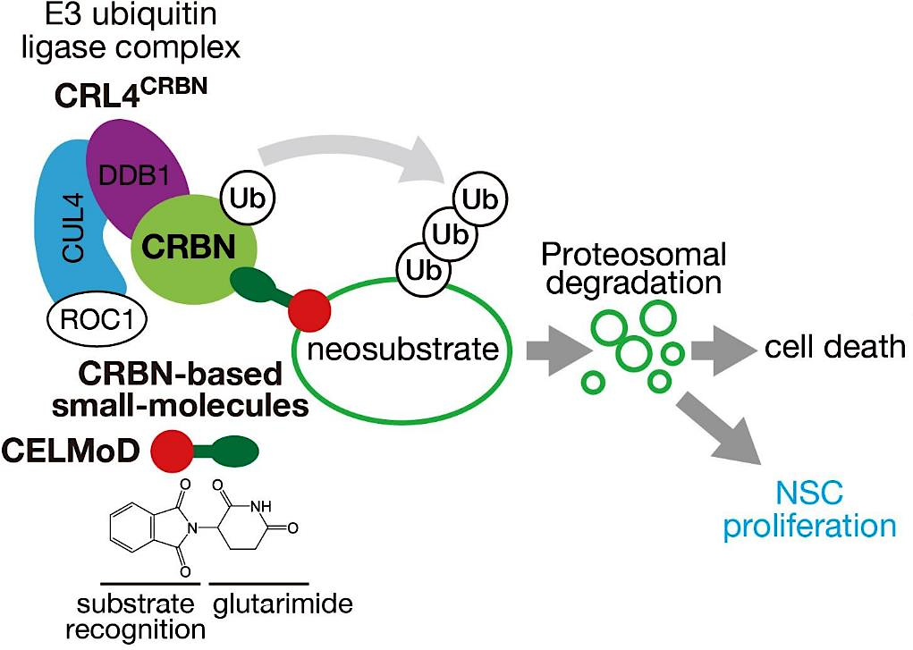
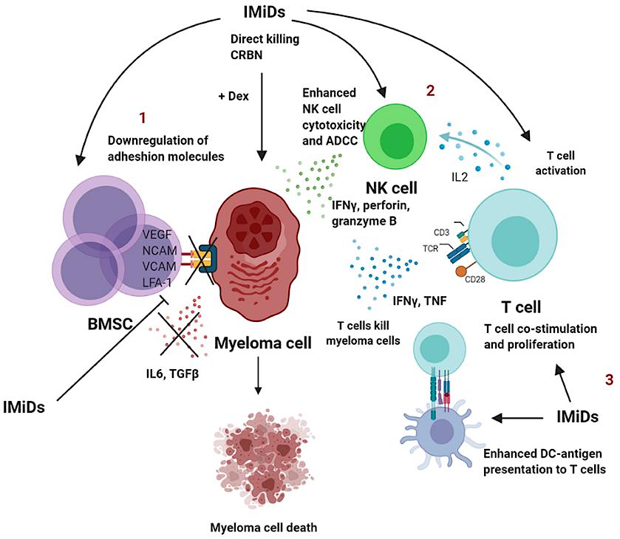
Novel immunomodulators for RRMM CELMoDs®: iberdomide¹ and mezigdomide²
/ CELMoDs
Neural stem cell proliferation
/ CELMoDs
/ CELMoDs
1. Lonial S, et al. Lancet Haematol 2022;9(11):e822–32. 2. Richardson PG, et al. N Engl J Med 2023;389(11):1009–22.
Figures adapted from: (left) Sato T, et al. Front Cell Dev Biol 2021;9:629326; (right) D’Souza C, et al. Front Immunol 2021;12:632399.

Slide 39
CELMoD doublets for RRMM Mezigdomide + dex: Phase 1/2 study, N=178
CC-92480-MM-001 first-in-human phase 1 trial: Mezigdomide + Dex
Dose escalation
30% high-risk cytogenetics, 35% EMD
Median 6 prior therapies
56% triple-class-refractory
Efficacy in dose expansion cohort
Median DOR 7.6 months
77 heavily pretreated RRMM patients
Dose expansion at RP2D
101 heavily pretreated RRMM patients
37% high-risk cytogenetics, 40% EMD
Median 6 prior therapies
100% triple-class-refractory
Median PFS 4.4 months
In patients with prior anti-BCMA therapy, median DOR 6.9 months and median PFS 5.4 months
ORR 25%
ORR 41%
ORR 30%
ORR 50%
Safety in dose escalation/expansion cohorts
Grade 3/4 neutropenia 71%/76%, anemia 38%/36%, thrombocytopenia 24%/28%, febrile neutropenia 9%/15%
Infections 74%/65% (Grade 3/4 40%/35%)
Treatment discontinuation due to AEs NR/6%
Richardson PG, et al. N Engl J Med 2023;389(11):1009–22.

Slide 40
CELMoD doublets for RRMM Mezigdomide + dex induces responses in patients with EMD
At start of treatment (study entry)
After 4 months of treatment with Mezi 1.0 mg, D1–21 every 28 days, + Dex
Richardson PG, et al. Blood 2022;140(Supplement 1):1366–8. Richardson PG, et al. N Engl J Med 2023;389(11):1009–22.

Slide 41
CELMoD triplets for RRMM Mezigdomide + Vd or Kd
2024
CC-92480-MM-002 Phase 1/2 Study: Mezigdomide + Vd / Kd^{1,2}
Mezigdomide + Vd (N=28)
42.9% high-risk cytogenetics
Mezigdomide + Vd 1.0mg (N=38) / 0.6 mg (N=11)
53.1% high-risk cytogenetics
Mezigdomide + Kd (N=27)
59.3% high-risk cytogenetics
Median 3 prior therapies
Median 1 prior therapy
Median 2 prior therapies
82.1% R-refractory
63.3% R-refractory
77.8% R-refractory
50.0% PI-refractory
16.3% PI-refractory
51.9% PI-refractory
50.0% CD38 mAb-refractory
34.7% CD38 mAb-refractory
74.1% CD38 mAb-refractory
Median duration of treatment: 12.5 cycles
Median duration of treatment: 15 cycles
Median duration of treatment: 12 cycles
Mezigdomide + Vd (N=28, dose escalation)
Mezigdomide + Vd (1.0 mg, N=38 / 0.6 mg, N=11)
Mezigdomide + Kd (N=27)
ORR 75.0%
ORR 84.2%
ORR 90.9%
ORR 61.5%
Median DOR 10.9 months
Median PFS 11.2–13.4 months
Grade 3/4 neutropenia 35.7%
Grade 3/4 thrombocytopenia 21.4%
Grade 3 anemia 14.3%
Infections 71.4% (Grade 3/4 17.9%)
Grade 3/4 pneumonia 10.7%
Median DOR 19.4 months
Median PFS 16.6 / 20.8 months
Grade 3/4 neutropenia 63.3%
Grade 3/4 thrombocytopenia 26.5%
Grade 3 anemia 6.1%
Infections 79.6% (Grade 3/4 32.7%)
Grade 3/4 pneumonia 22.4%
Median DOR 11.9 months
Median PFS 11.7–13.8 months
Grade 3/4 neutropenia 44.4%
Grade 3/4 thrombocytopenia 14.8%
Grade 3/4 anemia 14.8%
Infections 70.4% (Grade 3/4 33.3%)
Grade 3/4 pneumonia 3.7%
1. Oriol A, et al. Clin Lymphoma Myeloma Leukemia 2023;23(Suppl 2):S31. 2. Sandhu A, et al. Blood 2024;144(supplement 1):1025.

Slide 42
CELMoD triplets for RRMM Mezigdomide + Dara-dex or Elo-dex
2023
CC-92480-MM-002 Phase 1/2 Study: Mezigdomide + Dara-dex / Elo-dex¹
Mezigdomide + Dara-dex (N=56)
Mezigdomide + Elo-dex (N=20)
Median 3 prior therapies
Median 2 prior therapies
82.5% IMiD-refractory
85% prior CD38 mAb
61.4% PI-refractory
Median age 67 years
Median time since diagnosis 8.2 years
15.8% prior ASCT
8.8% prior CD38 mAb
Mezigdomide + Dara-dex (N=56)
Mezigdomide + Elo-dex (N=20)
ORR 75.0%
ORR 45%
DOR / PFS not mature
Grade 3/4 neutropenia 53.6%
Grade 3/4 thrombocytopenia 7.1%
Grade 3/4 anemia 10.7%
Grade 3/4 infections 19.6%
DOR / PFS not mature
Grade 3/4 neutropenia 40%
Grade 3/4 thrombocytopenia 10%
Grade 3/4 anemia 20%
Grade 3/4 infections 35%
1. Richardson PG, et al. Blood 2023;142(supplement 1):1013.

Slide 43
CELMoD triplets for RRMM Mezigdomide-dex + tazemetostat (EZH2 inhibitor) / BMS-986158 (BET inhibitor) / trametinib (MEK inhibitor)
2024
CA057-003 (NCT05372354) Phase 1/2 trial in patients with RRMM
Mezi-dex + Taz (N=16)
31.3% high-risk cytogenetics
Mezi-dex + BMS-986158 (N=20)
30.0% high-risk cytogenetics
Mezi-dex + Tram (N=20)
15.0% high-risk cytogenetics
Median 5 prior lines
Median 5 prior lines
Median 4 prior lines
68.8% prior T-cell redirecting therapy
60.0% prior T-cell redirecting therapy
45.0% prior T-cell redirecting therapy
87.5% CD38 mAb-refractory
85.0% CD38 mAb-refractory
90.0% CD38 mAb-refractory
90.0% triple-class refractory
81.3% triple-class refractory
75.0% triple-class refractory
Mezi-dex + Taz (N=16, dose escalation)
Mezi-dex + BMS-986158 (N=20, dose escalation)
Mezi-dex + Tram (N=20, dose escalation)
ORR 50.0%
ORR 35.0%
ORR 75.0%
Median DOR not reached
Median PFS 6.7 months
Grade 3/4 neutropenia 50.0%
Grade 3/4 thrombocytopenia 6.1%
Grade 3 anemia 12.5%
Infections 68.8% (Grade 3/4 25.0%)
Grade 3/4 pneumonia 12.5%
Median DOR not reached
Median PFS 4.6 months
Grade 3/4 neutropenia 65.0%
Grade 3/4 thrombocytopenia 40.0%
Grade 3 anemia 35.0%
Infections 50.0% (Grade 3/4 15.0%)
Grade 3/4 pneumonia 5.0%
Median DOR 6.5 months
Median PFS 8.7 months
Grade 3/4 neutropenia 80.0%
Grade 3/4 thrombocytopenia 15.0%
Grade 3/4 anemia 15.0%
Infections 85.0% (Grade 3/4 25.0%)
Grade 3/4 pneumonia 5.0%
Costa LJ, et al. Blood 2024;144(supplement 1):677.

Slide 44
CELMoD doublets for RRMM Iberdomide + dex
+ NDMM
CC-220-MM-001: Iberdomide-dex expansion cohorts^{1–4}
Cohort D (N=107)^{1,2}
29.9% high-risk cytogenetics
Median 6 prior therapies
100% IMiD-refractory
97.2% PI-refractory
100% CD38 mAb-refractory
97.2% triple-class refractory
Median duration of treatment: 4 cycles
Cohort D, Iberdomide-dex (N=107)^{1,2}
Cohort I, Iberdomide-dex (N=38)³
Cohort J1, Iberdomide-Vd (N=18)⁴
ORR 26.2%
ORR 36.8%
ORR 100%
Cohort I (N=38, BCMA-exposed)³
31.6% high-risk cytogenetics
Median 7 prior therapies
100% triple-class exposed
100% exposed to BCMA-targeted therapy: 36.8% prior CAR T cell therapy, 34.2% prior ADC, 23.7% prior T-cell engager
Median duration of treatment: 3.5 cycles
Median DoR 7.0 months
Median PFS 3.0 months
Median OS 10.4 months
Grade 3/4 neutropenia 25.2/19.6%, anemia 28.0/0%, thrombocytopenia 6.5/15.0%, infections 24.3/2.8% (COVID-19 4.7/1.9%)
Median DoR 7.5 months
Median PFS 2.4 months
Grade 3/4 AEs in 78/9%, including neutropenia 50.0%, anemia 28.9%, leukopenia 23.7%, thrombocytopenia 21.1%, infections 23.7% (pneumonia 21.1%)
No patients discontinued iberdomide due to AEs
Median follow-up 25 months
Median DoR NR
Grade 3/4 AEs in 82%, including infections 47% (pneumonia 18%), neutropenia 29%, PN 12%
Dose reductions due to AEs 59%
Cohort J1 (N=18, NDMM)
Median age 77.5 years
61% high-risk cytogenetics
1. Lonial S, et al. Blood 2021;138(suppl 1):abstract 162. 2. Lonial S, et al. Lancet Haematol 2022;9(11):e822–32. 3. Lonial S, et al. Blood 2022;140(suppl 1):abstract 1918. 4. White D, et al. J Clin Oncol 2025;43(16_supplement):7532.

Slide 45
CELMoD triplets for RRMM Iberdomide + Dara-dex, Vd, or Kd
CC-220-MM-001: Iberdomide + Dara-dex, Vd, or Kd¹
Iberdomide-Dara-dex (N=43)
16.3% EMD
Iberdomide-Vd (N=25)
16.0% EMD
Median 4 prior therapies
95.3% IMiD-refractory
86.0% PI-refractory
37.2% CD38 mAb-refractory
Median duration of treatment: 4 cycles
Iberdomide-Kd (N=9)
32.6% triple-class refractory
Median 5 prior therapies
80.0% IMiD-refractory
68.0% PI-refractory
80.0% CD38 mAb-refractory
48.0% triple-class refractory
Median duration of treatment: 6 cycles
22.2% EMD
Median 6 prior therapies
88.9% IMiD-refractory
66.7% PI-refractory
77.8% CD38 mAb-refractory
55.6% triple-class refractory
Median duration of treatment: 5 cycles
Iberdomide-Dara-dex (N=43)
Iberdomide-Vd (N=25)
Iberdomide-Kd (N=8)
ORR 45.9%
ORR 56.0%
ORR 50.0%
Median DoR not reached
Grade 3/4 hematologic AEs: neutropenia 12.8/53.8%, anemia 20.5/0%, thrombocytopenia 7.7/5.1%
Grade 3 nonhematologic AEs: fatigue 2.6%, diarrhea 2.6%
Infections 59.0% (grade 3/4: 10.3/5.1%)
Median DoR 35.7 weeks
Grade 3/4 hematologic AEs: neutropenia 20/8%, anemia 12/0%, thrombocytopenia 4/20%
Grade 3 nonhematologic AEs: diarrhea 4%, rash 4%
Infections 68% (grade 3/4: 16/4%)
Median DoR not reached
Grade 3/4 hematologic AEs (N=9): neutropenia 22.2/11.1%, anemia 0%, thrombocytopenia 0/11.1%
Grade 3 nonhematologic AEs: fatigue 11.1%
Infections 77.8% (grade 3/4: 22.2/11.1%)
1. Lonial S, et al. HemaSphere 2021;5(S2):49–50, abstract S187.

Slide 46
CELMoD triplets for RRMM Iberdomide + Ixa-dex or Cy-dex
Iberdomide + Ixa-dex as all-oral 2nd line therapy for RRMM (IFM Phase 2 I2D study)¹
Iberdomide + Cy-dex in RRMM
(Phase 2 ICON study)²
70 RRMM patients aged >70 years at first relapse
Efficacy, median follow-up 12 months
ORR 64% (VGPR 33%)
12-month OS 85%
Safety
Grade 3/4 neutropenia 46%, thrombocytopenia 9%
Median PFS 13 months (10 months in 26 patients refractory to R and Dara)
Median age 76 years (range 70–87)
50% with IMWG frailty score >2
On FISH in evaluable patients, 18.5% had del17p and 15% had t(4;14)
Prior R in 87% (74% refractory), Dara in 40% (37% refractory)
Infections 30% (grade 3/4 8%)
PN 20%
Diarrhea 19%
Discontinuation due to severe AE, n = 4
Median age 67 years (range 46–81); 30% high-risk cytogenetics
Efficacy, median follow-up 16.4 months
ORR 82% (48% ≥VGPR)
Safety
Grade ≥3 AEs: 49% neutropenia, 33% infections, 11% thrombocytopenia, 10% anemia, 3% fatigue, 2% TE events
61 RRMM patients after 2–4 prior lines
Median 3 prior lines
100% R exposed; 98% PI exposed (52% refractory); 85% CD38 mAb-exposed (77% refractory)
46% triple-class refractory
Median PFS 17.8 months (17.6 and 17.8 months in patients with 2 and >3 prior lines of therapy, respectively; 16.6 months in triple-class refractory patients)
18-month OS 71%
Grade 3 polyneuropathy in 2 patients with pre-existing grade 1 neuropathy
MagnetisMM-30: Elranatamab + iberdomide in RRMM
Phase 1b, open-label, prospective study (NCT06215118)
Dose-escalation and dose-optimization study, up to 36 and 60 patients, respectively
Patients with RRMM following 2–4 and 1–3 prior lines of therapy, respectively, and refractory to last line
All patients must have received prior IMiD and PI
Primary endpoint: DLTs and AEs
Secondary endpoints: ORR, CRR, time-to-event outcomes, PK, MRD-neg rate, immunogenicity
Lesokhin A, et al. J Clin Oncol 2025;43(16_supplement):TPS7566.
1. Touzeau C, et al. HemaSphere 2024;8(S1):1621–2. 2. Korst CLBM, et al. HemaSphere 2024;8(S1):1589–90.

Slide 47
Phase 3 studies of CELMoD triplets in RRMM
Study
Treatment
SUCCESSOR-1 (NCT05519085)¹
~810 patients
1–3 prior lines
Stage 1: Mezi + Vd
Determine recommended Mezi dose
Mezi + Vd
Primary endpoint: PFS
Initial completion: Nov 2025
Stage 2
Pom-Vd
SUCCESSOR-2 (NCT05552976)²
~525 patients
≥1 prior line
Stage 1: Mezi + Kd
Determine recommended Mezi dose
Mezi + Kd
Primary endpoint: PFS
Initial completion: Feb 2026
Stage 2
Kd
Iber 1.0 mg + Dara-dex
Primary endpoint: PFS
EXCALIBER-RRMM
(NCT04975997)³
Stage 1
~200 patients
1–2 prior lines
Iber 1.3 mg + Dara-dex
Stage 2
~664 patients
1–2 prior lines
Iber + Dara-dex
Iber 1.6 mg + Dara-dex
Dara-Vd
Initial completion: March 2026
Dara-Vd
1. Richardson PG, et al. Clin Lymphoma Myeloma Leuk 2023;23(Supplement 1):S495–6, abstract MM-372. 2. Richardson PG, et al. J Clin Oncol 2023;41(16_suppl):abstract TPS8070. 3. Lonial S, et al. Future Oncol 2025; doi: 10.1080/14796694.2025.2501920.

Slide 48
Conclusions and Future Directions
Belantamab mafodotin re-emerging as potential treatment option for RRMM
Positive findings from two phase 3 trials of belantamab mafodotin in RRMM^{1,2} suggesting new possible opportunities for belantamab mafodotin-based regimens in this setting
Under review for re-approval at the US FDA, EU EMA, and elsewhere
Novel triplet and quadruplet combinations demonstrating substantial efficacy in RRMM
Challenges include management of ocular toxicity and integration with other BCMA-targeted T-cell engaging therapies in the RRMM treatment algorithm³
Building on belantamab mafodotin: next-generation ADCs with novel targets also emerging
Phase 2 studies and ongoing Phase 3 trials of CELMoDs – Mezigdomide and Iberdomide – in RRMM
Encouraging activity of Mezigdomide⁴ and Iberdomide⁵ in heavily pretreated RRMM with numerous partner drugs/drug classes – addressing an urgent unmet medical need
Multiple CELMoD combination strategies currently under investigation in RRMM – e.g. SUCCESSOR-1, SUCCESSOR-2, EXCALIBER
Oral agents with potential to enhance activity of immune-based therapy and ease of real-world application⁶
Importance of optimizing use and treatment sequencing of CELMoDs in the context of immune therapies, with studies ongoing
Increasingly busy novel therapeutic landscape
Large number of novel therapies and potential targets resulting in an increasingly busy landscape
Development of novel therapies within the context of huge progress with immunotherapies (CAR Ts, BsAbs)^{7,8}
Challenging fiscal environment
Importance of optimizing the use of all available and emerging treatment options and novel targets to improve patient outcome – critical importance of patient subgroups, and immune exhaustion making small molecular approaches additionally important
1. Hungria V, et al. N Engl J Med 2024;391(5):393–407. 2. Dimopoulos MA, et al. N Engl J Med 2024;391(5):408–21. 3. Rees MJ, Kumar S. Leuk Lymphoma 2024;65(3):287–300. 4. Richardson PG, et al. N Engl J Med 2023;389(11):1009–22. 5. Lonial S, et al. Lancet Haematol 2022;9(11):e822–32. 6. Liu Y, et al. Exp Rev Hematol 2024;17(8):445–65. 7. Rodriguez-Otero P, et al. Lancet Oncol 2024;25(5):e205–16. 8. Martino M, et al. Expert Rev Hematol 2024;17(7):375–90.

Slide 49
Appendix

Slide 50
DREAMM-10 Trial: Phase III Study of Belantamab Mafodotin with Lenalidomide and Dexamethasone (BRd) versus Daratumumab with Lenalidomide and Dexamethasone (DRd) in Transplant-Ineligible Newly Diagnosed MM
Trial identifier: NCT06679101
Estimated enrollment: 520
Key inclusion criteria:
Newly diagnosed, transplant-ineligible MM
ECOG PS 0-2
BRd
(belantamab mafodotin, lenalidomide, dexamethasone)
R
1:1
DRd
(daratumumab, lenalidomide, dexamethasone)
Lonial S et al. ASCO 2025;Abstract TPS7567; www.clinicaltrials.gov. NCT06679101. Accessed May 2025.

Slide 51
Agenda
Introduction: ASCO 2025 Showstoppers
Module 1: Up-Front Treatment of Multiple Myeloma (MM) – Survey Questions
Module 2: Emerging Novel Therapies for Relapsed/Refractory (R/R) MM – Faculty Presentation
Module 3: Emerging Novel Therapies for R/R MM – Survey Questions
Module 4: Current Management of R/R MM – Faculty Presentation
Module 5: Current Management of R/R MM – Survey Questions
Module 6: ASCO and EHA 2025

Slide 52
Questions from General Medical Oncologists — Belantamab Mafodotin
I need an update on the trials, I know nothing
Would like to learn
Do you see belantamab being used as part of first-line treatment in the future?

Slide 53
Questions from General Medical Oncologists — Belantamab Mafodotin
Based on the latest Phase III data, in what clinical scenarios would belantamab mafodotin in combination therapy be preferable to bispecific antibodies in relapsed/refractory settings?
Which is the best partner for belantamab and which is the best dosing schedule?
How are you planning to space belamaf doses once it’s approved – DREAMM-8 protocol and beyond?

Slide 54
Questions from General Medical Oncologists — Belantamab Mafodotin
How do community providers manage the occular toxicities of belantamab when local ophthalmologists have limited experience dealing with these side effects?
I am only informed because my wife is an ophthalmologist, but in general how often is screening done and can an optometrist do it?

Slide 55
Questions from General Medical Oncologists — Belantamab Mafodotin
In practice, it is very difficult to get patients to do their ocular screenings — how do investigators get their patients (not on trial, where there is a lot of support) to the eye specialist and communicate what needs to be done to clear for therapy? The eye specialist has no knowledge of the therapy, and communication is very challenging between providers because it goes through multiple levels of phone trees and providers.
Would you be comfortable giving belantamab if you did not have rapid access to optho?

Slide 56
Questions from General Medical Oncologists — CELMoDs
What do you see as the future role of iberdomide and mezigdomide? How do they differ from lenalidomide and pomalidomide?

Slide 57
Agenda
Introduction: ASCO 2025 Showstoppers
Module 1: Up-Front Treatment of Multiple Myeloma (MM) – Survey Questions
Module 2: Emerging Novel Therapies for Relapsed/Refractory (R/R) MM – Faculty Presentation
Module 3: Emerging Novel Therapies for R/R MM – Survey Questions
Module 4: Current Management of R/R MM – Faculty Presentation
Module 5: Current Management of R/R MM – Survey Questions
Module 6: ASCO and EHA 2025

Slide 58
Current Management of Relapsed/Refractory (R/R) Multiple Myeloma (MM)
Ajay K Nooka, MD, MPH
Professor, Department of Hematology and Medical Oncology
Director, Myeloma Program
Associate Director of Clinical Research
Winship Cancer Institute
Emory University School of Medicine
Atlanta, Georgia

Slide 59
Research database documenting the effectiveness of idecabtagene vicleucel (ide-cel) and ciltacabtagene autoleucel (cilta-cel) in patients with heavily pretreated MM
Chimeric antigen receptor T-cell (CAR-T) therapies, idecabtagene vicleucel (IC) and ciltacabtagene autoleucel (CC) are approved for specific indications in RRMM patients.
Comparative real-world (RW) efficacy data are limited.
Evaluated overall survival (OS) and time to next treatment (TTNT) for IC versus CC in a RW setting using the TriNetX, a global RW data platform, providing insights to inform therapeutic decision-making.
Adult RRMM pts (ICD-10 code C90.0) treated with IC (n=485) or CC (n=392) between 2021 and 2024 were included in analysis.
Khan E, Ilyas R, Jin M, Ramesh N, Mewawalla P, Sadashiv S, et al. Comparative efficacy of idecabtagene vicleucel and ciltacabtagene autoleucel in relapsed/refractory multiple myeloma: Real-world analysis of overall survival and time to next treatment. Journal of Clinical Oncology. 2025;43(16_suppl):e19532-e.

Slide 60
Propensity score matching with 37 variables (demographic, patient and disease characteristics) balanced cohorts
Characteristic | Ide-cel (IC) (252) | Cilta-cel (CC) (252) | P-value
Age at CAR-T (mean +/-SD yrs) | 65.3 +/-9.4 | 65.2 +/-9.5 | 0.94
Female vs Male (%) | 42 vs 58 | 44 vs 56 | 0.65
White and African American race (%) | 76 vs 15 | 76 vs 17 | 1.0/0.46
Bortezomib/Carfilzomib/Ixazomib (%) | 37/28/8 | 38/30/8 | 0.93/0.62/0.87
Lenalidomide/Pomalidomide/Thalidomide (%) | 50/44/8 | 51/45/7 | 0.72/0.86/0.50
Daratumumab/Isatuximab/Elotuzumab (%) | 36/4/6 | 36/4/6 | 0.85/1.0/0.71
Belantamab/Teclistamab/Talquetamab (%) | 4/4/4 | 4/4/4 | 1.0/1.0/1.0
Elevated LDH (>220U; %) | 75 | 75 | 0.92
Albumin ≥3.5 g/dL/ β2-microglobulin ≥5.5 mg/L | 95/15 | 95/15 | 0.69/1.0
Khan E, Ilyas R, Jin M, Ramesh N, Mewawalla P, Sadashiv S, et al. Comparative efficacy of idecabtagene vicleucel and ciltacabtagene autoleucel in relapsed/refractory multiple myeloma: Real-world analysis of overall survival and time to next treatment. Journal of Clinical Oncology. 2025;43(16_suppl):e19532-e.
Notes:
baseline characteristics were well-balanced between groups

Slide 61
Median follow up (f/u) was 14.2 months for IC and 8.5 months for CC.
Median OS was not reached (NR) in either group.
48 patients in IC and 32 patients in CC died during f/u.
Estimated 2-year survival probabilities IC vs CC: 77% vs 73% (HR: 1.051; 95% CI: 0.636–1.734; p=0.847).
Median TTNT was 17.7 months for IC and NR for CC.
118 pts in IC and 58 pts in CC had a TTNT event.
At 2 years, TTNT probabilities IC vs CC: 36% vs 52% (P<0.0001; HR for CC vs IC: 0.60; 95% CI: 0.44-0.83).
In this RW analysis, CC showed improved durability in delaying subsequent therapy compared to IC.
This advantage did not translate into improved OS, likely from shorter follow-up period.
Differences in follow-up duration and RW data limitations, including potential missing data, may have influenced outcomes.
Khan E, Ilyas R, Jin M, Ramesh N, Mewawalla P, Sadashiv S, et al. Comparative efficacy of idecabtagene vicleucel and ciltacabtagene autoleucel in relapsed/refractory multiple myeloma: Real-world analysis of overall survival and time to next treatment. Journal of Clinical Oncology. 2025;43(16_suppl):e19532-e.

Slide 64
Published data from the Phase III KarMMa-3 and CARTITUDE-4 trials of ide-cel and cilta-cel, respectively, in earlier lines of treatment; recently presented overall survival findings from CARTITUDE-4
Sidana S, Martinez-Lopez J, Khan AM, Oriol A, Spencer A, Dhakal B, et al. Ciltacabtagene autoleucel (cilta-cel) vs standard of care (SOC) in patients (pts) with relapsed/refractory multiple myeloma (MM): CARTITUDE-4 survival subgroup analyses. Journal of Clinical Oncology. 2025;43(16_suppl):7539-.

Slide 65
Sidana S, Martinez-Lopez J, Khan AM, Oriol A, Spencer A, Dhakal B, et al. Ciltacabtagene autoleucel (cilta-cel) vs standard of care (SOC) in patients (pts) with relapsed/refractory multiple myeloma (MM): CARTITUDE-4 survival subgroup analyses. Journal of Clinical Oncology. 2025;43(16_suppl):7539-.

Slide 66
At a median follow-up was 33.6 months, the PFS and OS benefit of cilta-cel over SOC in the ITT analysis was consistent across pts with standard-risk cytogenetics and high-risk cytogenetics, defined as del(17p), t(4;14), t(14;16), or gain/amp(1q)
Cilta-cel, n | SOC, n | Median PFS cilta-cel, mo | Median PFS SOC, mo | HR (95% CI) | Median OS cilta-cel, mo | Median OS SOC, mo | HR (95% CI)
Standard-risk cytogenetics | 69 | 70 | NR | 21 | 0.43 (0.26–0.72) | NR | NR
High-risk cytogeneticsª | 123 | 132 | 37 | 10 | 0.38 (0.27–0.52) | NR | 38
del(17p) | 49 | 43 | 30 | 9 | 0.40 (0.24–0.68) | NR | NR
t(4;14) | 30 | 30 | 37 | 7 | 0.34 (0.17–0.68) | NR | 27
gain/amp(1q) | 89 | 107 | 37 | 10 | 0.39 (0.27–0.57) | NR | 38
≥2 cytogenetic abnormalitiesª | 43 | 49 | 30 | 7 | 0.43 (0.25–0.73) | NR | 23
Sidana S, Martinez-Lopez J, Khan AM, Oriol A, Spencer A, Dhakal B, et al. Ciltacabtagene autoleucel (cilta-cel) vs standard of care (SOC) in patients (pts) with relapsed/refractory multiple myeloma (MM): CARTITUDE-4 survival subgroup analyses. Journal of Clinical Oncology. 2025;43(16_suppl):7539-.

Slide 67
Comparing cilta-cel (n=21) vs SOC (n=18) in pts with extramedullary disease (EMD)
median PFS was 13 mo vs 4 mo (HR, 0.71 [95% CI, 0.34–1.49])
median OS was not reached (NR) vs 16 mo (HR, 0.61 [95% CI, 0.26–1.47])
Comparing cilta-cel vs SOC by prior LOT
median PFS for 1 pLOT [Ciltacel (N=68) vs SOC (N=68)]: NR vs 17 mo (HR, 0.41 [95% CI, 0.25–0.67]), median OS NR vs NR
median PFS for 2 pLOT [Ciltacel (N=83) vs SOC (N=87)]: NR vs 12 mo (HR, 0.30 [95% CI, 0.19–0.49]), median OS NR vs NR
median PFS for 3 pLOT [Ciltacel (N=57) vs SOC(N=56)]: NR vs 8 mo (HR, 0.20 [95% CI, 0.11–0.34]), median OS NR vs 34 mo (HR, 0.49 [95% CI, 0.26–0.91])
Compared with SOC, cilta-cel improved PFS and OS in pts with high-risk cytogenetics, suggesting it may overcome the poor prognosis associated with these high-risk features
These data continue to support a positive benefit-risk ratio for cilta-cel in pts with lenalidomide-refractory MM as early as after first relapse
Sidana S, Martinez-Lopez J, Khan AM, Oriol A, Spencer A, Dhakal B, et al. Ciltacabtagene autoleucel (cilta-cel) vs standard of care (SOC) in patients (pts) with relapsed/refractory multiple myeloma (MM): CARTITUDE-4 survival subgroup analyses. Journal of Clinical Oncology. 2025;43(16_suppl):7539-.

Slide 68
Available efficacy and safety findings with the BCMA-directed bispecific antibodies teclistamab and elranatamab in R/R MM

Slide 69
Teclistamab and Elranatamab approvals
MajesTEC-1
MagnetisMM-3
EMA approval: Both teclistamab and elranatamab are indicated as monotherapy for the treatment of adult patients with relapsed and refractory multiple myeloma, who have received at least three prior therapies, including an immunomodulatory agent, a proteasome inhibitor, and an anti-CD38 antibody and have demonstrated disease progression on the last therapy.
FDA approval: Teclistamab and elranatamab are indicated as monotherapy for the treatment of adult patients with relapsed and refractory multiple myeloma, who have received at least four prior therapies, including an immunomodulatory agent, a proteasome inhibitor, and an anti-CD38 antibody and have demonstrated disease progression on the last therapy.

Slide 70
Key differences in study design and baseline characteristics

Slide 71
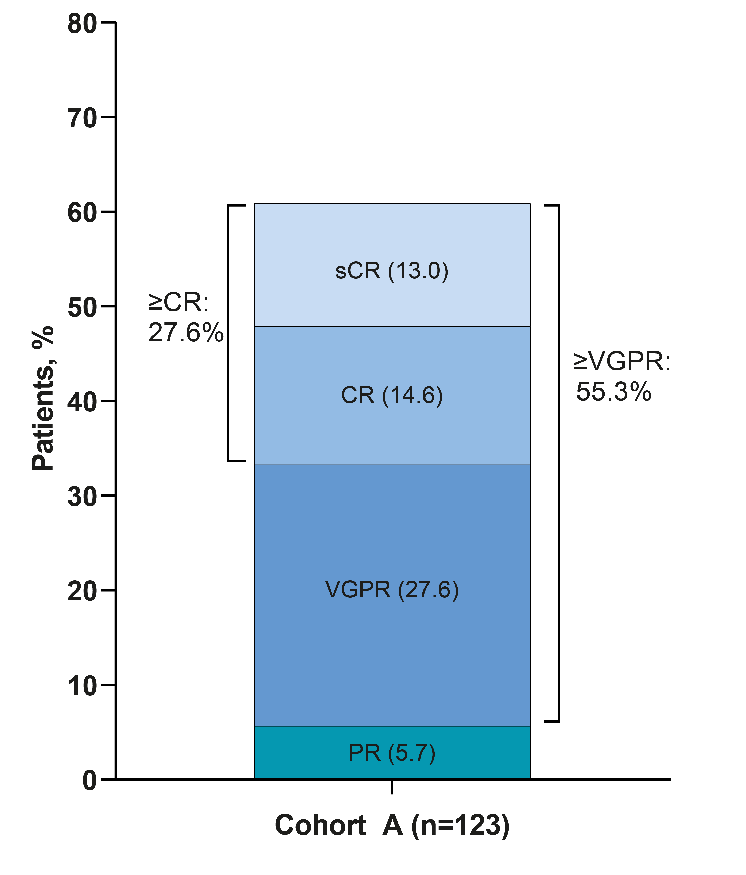
MajesTEC-1 and MagnetisMM-3: ORR
Median follow up 17.6 months
85.7% (48/56) of minimal residual disease (MRD)-evaluable pts were MRD negative (10–5 threshold)
Responses were reached quickly, at a median of 1.2 months, with deep responses taking approximately 4.5 months
ORR, 61.0% (95% CI, 51.8−69.6)
MRD negativity rate was 90.0% in sCR/CR patients who were MRD evaluable (n=30)
Responses were reached quickly, at a median of 1.2 months, with deep responses taking approximately 4.6 months
37.4%
37.4%
Best response =
sCR
CR
VGPR
PR
Usmani SZ, et al. Presented at ASCO; June 2–6, 2023; Chicago, IL, USA & Virtual. Poster # 8034.
Garfall AL, et al. ASCO 2024; Abstract 7540.
Tomasson MH, et al. ASH 2023 Blood (2023) 142 (Supplement 1): 3385.

Slide 72
MajesTEC-1 and MAgnetisMM-3: PFS
Median progression-free survival (mPFS): 11.4 months
Median overall survival (mOS): 22.2 months
Usmani SZ, et al. Presented at ASCO; June 2–6, 2023; Chicago, IL, USA & Virtual. Poster # 8034.
Garfall AL, et al. ASCO 2024; Abstract 7540.

Slide 73
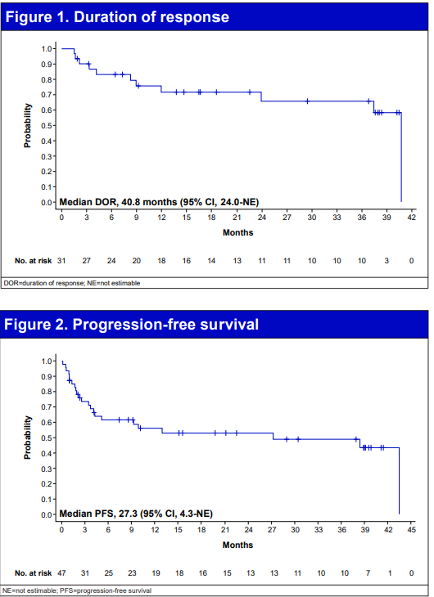
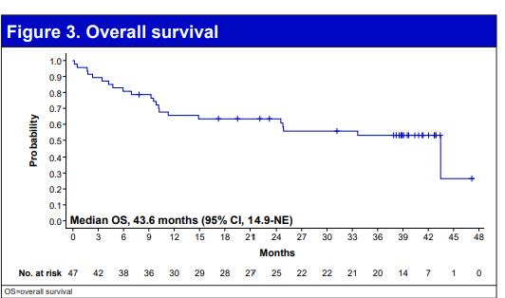
Efficacy and Safety of Less Frequent Dosing With Elranatamab in Patients With Relapsed or Refractory Multiple Myeloma: A US Subgroup Analysis From MagnetisMM-3
Among the 123 BCMA-naive patients in Cohort A, 47 were enrolled in the US
With a median follow-up of 39.6 months
Median ORR was 66.0%, median DOR was 40.8 months but may not yet be mature
Median PFS was 27.3 months
Median OS was 43.6 months but may not yet be mature
Nooka AK, Strouse CS, Larson SM, Lesokhin AM, Yanovsky AV, Vesole DH, et al. Efficacy and safety of less frequent dosing with elranatamab (ELRA) in patients with relapsed or refractory multiple myeloma (RRMM): A US subgroup analysis from MagnetisMM-3. Journal of Clinical Oncology. 2025;43(16_suppl):7549-.

Slide 74
Extended follow-up from the pivotal Phase I/II MonumenTAL-1 study of talquetamab in R/R MM
Talquetamab (Tal) is the first and only approved anti-GPRC5D bispecific antibody (BsAb) for relapsed/refractory multiple myeloma (RRMM)
Extended mFU of 30–38 mo at ASCO 2025
3 cohorts
Prior TCR naïve 0.4 mg/kg weekly (QW) (n=143) - 38.2 months
Prior TCR naïve 0.8 mg/kg every other week (Q2W) (n=154) - 31.2 months
Prior TCR exposed 0.4 mg/kg QW or 0.8 mg/kg Q2W (n=78) - 30.3 months
ORR unchanged (QW vs Q2W vs prior TCR) - 74.1% vs 69.5% vs 66.7%
mDOR (QW vs Q2W vs prior TCR) - 9.5 vs 17.5 vs 19.2 months
mPFS (QW vs Q2W vs prior TCR) - 7.5 vs 11.2 vs 7.7 months
mOS (QW vs Q2W vs prior TCR) - 34.0 vs NR vs 28.3 months
36-month OS rates (QW vs Q2W vs prior TCR) - 49% vs 61% vs 45%
Rasche L, Schinke CD, Touzeau C, Minnema M, Donk NWCJvd, Rodríguez-Otero P, et al. Efficacy and safety from the phase 1/2 MonumenTAL-1 study of talquetamab, a GPRC5D×CD3 bispecific antibody, in patients with relapsed/refractory multiple myeloma: Analyses at an extended median follow-up. Journal of Clinical Oncology. 2025;43(16_suppl):7528

Slide 75
Most common AEs
CRS all grades, unchanged (QW vs Q2W) - 79% vs 72.4%
CRS grade 2, unchanged (QW vs Q2W) - 14.7% vs 17.2%
GPRC5D-associated AEs (taste related) (QW vs Q2W vs prior TCR) - 72% vs 71.4% vs 75.6%
rates of dose reductions due to taste related AEs – 7 vs 3.9% vs 5.1%
rates of discontinuation due to taste related AEs – 0 vs 1.9% vs 0%
GPRC5D-associated AEs (skin related) (QW vs Q2W vs prior TCR) - 56.6% vs 73.4% vs 64.1%
rates of dose reductions due to skin related AEs – 3.5 vs 0.6% vs 2.6%
rates of discontinuation due to skin related AEs – 1.4 vs 0.6% vs 0%
GPRC5D-associated AEs (nail related) (QW vs Q2W vs prior TCR) - 55.2% vs 53.2% vs 59%
rates of dose reductions due to nail related AEs – 0.7 vs 0.6% vs 1.3%
rates of discontinuation due to nail related AEs – 0 vs 0% vs 0%
GPRC5D-associated AEs (rash related) (QW vs Q2W vs prior TCR) - 39.9% vs 29.9% vs 32.1%
rates of dose reductions due to rash related AEs – 0.7 vs 0.6% vs 0%
rates of discontinuation due to rash related AEs – 0 vs 0% vs 0%
Infections, any-grade (QW vs Q2W vs prior TCR) occurred in 61% vs 71% vs 78%
Infections, grade 3 and 4 (QW vs Q2W vs prior TCR) occurred in 23% vs 21% vs 26%
A new safety signal, ataxia/balance disorders, was recently identified in association with Talquetamab and had low prevalence in MonumenTAL-1
No death reported due to Talquetamab-related AEs
Rasche L, Schinke CD, Touzeau C, Minnema M, Donk NWCJvd, Rodríguez-Otero P, et al. Efficacy and safety from the phase 1/2 MonumenTAL-1 study of talquetamab, a GPRC5D×CD3 bispecific antibody, in patients with relapsed/refractory multiple myeloma: Analyses at an extended median follow-up. Journal of Clinical Oncology. 2025;43(16_suppl):7528

Slide 76
Agenda
Introduction: ASCO 2025 Showstoppers
Module 1: Up-Front Treatment of Multiple Myeloma (MM) – Survey Questions
Module 2: Emerging Novel Therapies for Relapsed/Refractory (R/R) MM – Faculty Presentation
Module 3: Emerging Novel Therapies for R/R MM – Survey Questions
Module 4: Current Management of R/R MM – Faculty Presentation
Module 5: Current Management of R/R MM – Survey Questions
Module 6: ASCO and EHA 2025

Slide 77
Questions from General Medical Oncologists — CAR T-Cell Therapy
I live in an area where the nearest CAR T center is 1 hour away and crosses state lines. The closest within my state is 1-1/2 hours away. What can be done for community practice to be able to give cellular therapy and to increase access?

Slide 78
Questions from General Medical Oncologists — CAR T-Cell Therapy
How should we sequence CAR T-cell therapy relative to bispecifics and other novel agents in a patient with triple-class refractory MM and rapid disease progression?
When should we be referring for CAR T? In the second line? What should we give to prepare for CAR T in terms of regimens that optimize CAR T and control disease?

Slide 79
Questions from General Medical Oncologists — CAR T-Cell Therapy
What are the most effective real-world strategies for mitigating prolonged cytopenias and neurotoxicity in patients post-CAR T-cell therapy for MM?
What is the incidence of CAR T-associated secondary lymphomas and are there particular subsets of patients more likely to develop this complication?

Slide 80
Questions from General Medical Oncologists — CAR T-Cell Therapy
How to decrease incidence of neurotoxicity (Parkinsonism like) AEs for patients who received ciltacabtagene autoleucel)?
How do you view the efficacy of Anito-Cel vs. ciltacabtagene autoleucel?

Slide 81
Questions from General Medical Oncologists — CAR T-Cell Therapy
Specific considerations of long term toxicities that should be considered after 1 year of therapy
I have one patient developed CMV infection and severe fatigue after CART. No myeloma recurrence. CMV finally cleared but remains very fatigued and depressed. Other than providing IVIG and monitoring myeloma, what should a community oncologist do for post-CART patients?
How can the community-based oncologist assist the academic center in the management of these patients? What can we be doing better?

Slide 82
Questions from General Medical Oncologists — Bispecific Antibodies
A significant barrier is access to timely CAR T-cell therapy or bispecifics for eligible patients due to insurance delays and logistical challenges at treatment centers, which can lead to disease progression before therapy initiation.
What is the correct sequence?
How do teclistamab and elranatamab compare in terms of response durability and infection risk, and what patient factors influence selection between them?

Slide 83
Questions from General Medical Oncologists — Bispecific Antibodies
Given the proliferation of cellular/immunotherapies available across disease states, these are going to need to be given in the community. How can community docs team up better to be qualified and competent to choose and manage these medications?
Have you used two different bsA molecules back-to-back (BCMA followed by GPRC5D or vice versa), and how have the outcomes been? I have a patient with RRMM who received BsA (Teclistamab) in the 5th line but had to be discontinued due to Grade 4 infections. For such patients with significant infection risk on 1 bsA, what do you recommend next to keep the disease in check and allow them to recover for the next line of different BsA, like Talquetamab?

Slide 84
Agenda
Introduction: ASCO 2025 Showstoppers
Module 1: Up-Front Treatment of Multiple Myeloma (MM) – Survey Questions
Module 2: Emerging Novel Therapies for Relapsed/Refractory (R/R) MM – Faculty Presentation
Module 3: Emerging Novel Therapies for R/R MM – Survey Questions
Module 4: Current Management of R/R MM – Faculty Presentation
Module 5: Current Management of R/R MM – Survey Questions
Module 6: ASCO and EHA 2025

Slide 85
Isatuximab (Isa) subcutaneous (SC) via an on-body delivery system (OBDS) vs Isa intravenous (IV), plus pomalidomide and dexamethasone (Pd) in relapsed/refractory multiple myeloma (RRMM): Results of the randomized, non-inferiority, phase 3 IRAKLIA study. Leleu XP et al. ASCO 2025; Abstract 7506 Belantamab mafodotin plus lenalidomide/dexamethasone in newly diagnosed intermediate-fit & frail multiple myeloma patients: Long-term efficacy and safety from the phase 1/2 BELARD clinical trial. Terpos E et al ASCO 2025; Abstract 7512 Design of the phase 3 DREAMM-10 study: Belantamab mafodotin plus lenalidomide and dexamethasone (BRd) vs daratumumab plus lenalidomide and dexamethasone (DRd) in transplant-ineligible, newly diagnosed multiple myeloma (TI-NDMM). Lonial S et al ASCO 2025;Abstract TPS7567
ASCO 2025 | ORAL ABSTRACT SESSION | JUNE 1-3

Slide 86
Long-term (≥5 year) remission and survival after treatment with ciltacabtagene autoleucel (cilta-cel) in CARTITUDE-1 patients (pts) with relapsed/refractory multiple myeloma (RRMM). Vorhees PM et al ASCO 2025; Abstract 7507 First-in-human study of JNJ-79635322 (JNJ-5322), a novel, next-generation trispecific antibody (TsAb), in patients (pts) with relapsed/refractory multiple myeloma (RRMM): Initial phase 1 results. Van de Donk N et al. ASCO 2025; Abstract 7505
ASCO 2025 | ORAL ABSTRACT SESSION | JUNE 1-3

Slide 87
EHA 2025 Upcoming Abstracts in MM June 12-15, 2025
S201 Kaur G et al. Phase 2 registrational study of anitocabtagene autoleucel for relapsed and/or refractory multiple myeloma (RRMM): Updated results from iMMAGINE-1.
S203 Leleu X et al. Isatuximab subcutaneous via an on-body delivery system versus isatuximab intravenous, plus pomalidomide and dexamethasone, in relapsed/refractory multiple myeloma: The randomized phase 3 IRAKLIA study.
S192 Jagannath S et al. Long-term (≥5 year) remission and survival after treatment with ciltacabtagene autoleucel in CARTITUDE-1 patients with relapsed/refractory multiple myeloma.
S100 Popat R et al. First-in-human study of JNJ-79635322 (JNJ-5322), a novel, next-generation trispecific antibody, in patients with relapsed/refractory multiple myeloma: Initial phase 1 results.

Slide 88
EHA 2025 Upcoming Abstracts in MM June 12-15, 2025
PS1793 Dimopoulos M et al. Phase 3 DREAMM-10 study design: Belantamab mafodotin plus lenalidomide and dexamethasone vs daratumumab plus lenalidomide and dexamethasone in transplant-ineligible newly-diagnosed multiple myeloma.
PF733 Terpos E et al. Extended dosing schedule of belantamab mafodotin in combination with daratumumab, lenalidomide and dexamethasone in patients with newly diagnosed multiple myeloma: The phase 1/2 BELADRD study.
PS1741 Cavo M et al Real-world effectiveness and safety of belantamab mafodotin (belamaf) monotherapy in patients (pts) with relapsed/refractory multiple myeloma (RRMM) treated in Europe.
PS1752 Terpos E et al. Clinical management of belantamab mafodotin-associated ocular events: Practical guidance from the belamaf expert experience program.
PF783 Quach H et al. Belantamab for the treatment of multiple myeloma: Results from part 1 of the first-in-human phase 1/2 DREAMM-20 trial.

Slide 89
Consensus or Controversy? Clinical Investigators Provide Perspectives on the Current and Future Clinical Care of Patients with Metastatic Breast Cancer
Monday, June 2, 2025 7:00 PM – 9:00 PM CT (8:00 PM – 10:00 PM ET)
Faculty
Harold J Burstein, MD, PhD
Javier Cortés, MD, PhD
Rebecca A Dent, MD, MSc
Kevin Kalinsky, MD, MS
Joyce O’Shaughnessy, MD
Moderator
Hope S Rugo, MD

Slide 90
Dear Attendees, If you are interested in joining our Breast Cancer symposium webcast starting at 7:00 PM central time (8:00 PM ET), please use the link below to register on Zoom. THIS LINK IS ALSO POSTED IN THE ZOOM CHAT ROOM. https://us02web.zoom.us/webinar/register/WN_O9YZp8BaS2-uCMIWtt-hFg#/registration If you have already registered for the Breast Cancer ​webcast, you should have received an email directly from Zoom with the viewing instructions for the webcast. If not, please use the link above to register again and you will be automatically redirected to the Zoom event. Thank you for your participation!

Slide 91
Thank you for joining us! Please take a moment to complete the survey currently up on Zoom. Your feedback is very important to us. The survey will remain open for 5 minutes after the meeting ends. Information on how to obtain CME credit is provided in the Zoom chat room. Attendees will also receive an email in 1 to 3 business days with these instructions.

