Slide 1
Data + Perspectives: Clinical Investigators
Discuss the Current and Future Clinical Care of
Patients with HER2-Positive Gastrointestinal Cancers
Sunday, June 1, 2025
7:00 PM – 8:30 PM CT (8:00 PM – 9:30 PM ET)
Faculty
Haley Ellis, MD
Sara Lonardi, MD
Kanwal Raghav, MD, MBBS
Moderator
Christopher Lieu, MD

Slide 2




Faculty
Haley Ellis, MD
Medical Oncologist
Massachusetts General Hospital
Instructor of Medicine
Harvard Medical School
Boston, Massachusetts
Kanwal Raghav, MD, MBBS
Associate Professor
Gastrointestinal Medical Oncology
Associate Vice President (AVP)
Ambulatory Medical Operations
Executive Medical Director (EMD)
Ambulatory Treatment Centers
The University of Texas
MD Anderson Cancer Center
Houston, Texas
Sara Lonardi, MD
Director of the Oncology 1 Unit
Veneto Institute of Oncology IOV - IRCCS
Padua, Italy
Moderator
Christopher Lieu, MD
Professor of Medicine
Associate Director for Clinical Research
Co-Director, GI Medical Oncology
University of Colorado Cancer Center
Aurora, Colorado

Slide 3
Dr Ellis — Disclosures
Faculty
Advisory Committees | AstraZeneca Pharmaceuticals LP, Cogent Biosciences, Jazz Pharmaceuticals Inc
Honoraria | Incyte Corporation, Jazz Pharmaceuticals Inc
Nonrelevant Financial Relationships | Medscape, OncLive, The Jackson Laboratory

Slide 4
Dr Lonardi — Disclosures
Faculty
No relevant conflicts of interest to disclose.

Slide 5
Dr Raghav — Disclosures
Faculty
Advisory Committees and Contracted Research | AbbVie Inc, AstraZeneca Pharmaceuticals LP, Daiichi Sankyo Inc, Eisai Inc, Guardant Health, Janssen Biotech Inc, Merck, Pfizer Inc
Data and Safety Monitoring Boards/Committees | AbbVie Inc, Pfizer Inc

Slide 6
Dr Lieu — Disclosures
Moderator
Consulting Agreements (to Institution) | Pfizer Inc
Contracted Research (All to Institution) | Genentech, a member of the Roche Group, Janssen Biotech Inc, Sanofi

Slide 7
Dr Love — Disclosures
Dr Love is president and CEO of Research To Practice. Research To Practice receives funds in the form of educational grants to develop CME activities from the following companies: Aadi Bioscience, AbbVie Inc, ADC Therapeutics, Alexion Pharmaceuticals, Amgen Inc, Array BioPharma Inc, a subsidiary of Pfizer Inc, Arvinas, Astellas, AstraZeneca Pharmaceuticals LP, Aveo Pharmaceuticals, Bayer HealthCare Pharmaceuticals, BeiGene Ltd, Black Diamond Therapeutics Inc, Blueprint Medicines, Boehringer Ingelheim Pharmaceuticals Inc, Bristol Myers Squibb, Clovis Oncology, Coherus BioSciences, CTI BioPharma, a Sobi Company, Daiichi Sankyo Inc, Eisai Inc, Elevation Oncology Inc, Exact Sciences Corporation, Exelixis Inc, Genentech, a member of the Roche Group, Genmab US Inc, Geron Corporation, Gilead Sciences Inc, GSK, Hologic Inc, ImmunoGen Inc, Incyte Corporation, Ipsen Biopharmaceuticals Inc, Jazz Pharmaceuticals Inc, Johnson & Johnson, Karyopharm Therapeutics, Kite, A Gilead Company, Kura Oncology, Legend Biotech, Lilly, MEI Pharma Inc, Merck, Mersana Therapeutics Inc, Mirati Therapeutics Inc, Mural Oncology Inc, Natera Inc, Novartis, Novartis Pharmaceuticals Corporation on behalf of Advanced Accelerator Applications, Novocure Inc, Nuvalent, Pfizer Inc, Pharmacyclics LLC, an AbbVie Company, Puma Biotechnology Inc, Regeneron Pharmaceuticals Inc, Rigel Pharmaceuticals Inc, R-Pharm US, Sanofi, Seagen Inc, Servier Pharmaceuticals LLC, SpringWorks Therapeutics Inc, Stemline Therapeutics Inc, Syndax Pharmaceuticals, Taiho Oncology Inc, Takeda Pharmaceuticals USA Inc, TerSera Therapeutics LLC, and Tesaro, A GSK Company.

Slide 8
Commercial Support
This activity is supported by educational grants from AstraZeneca Pharmaceuticals LP, Daiichi Sankyo Inc, and Jazz Pharmaceuticals Inc.
Research To Practice CME Planning Committee Members,
Staff and Reviewers
Planners, scientific staff and independent reviewers for Research To Practice have no relevant conflicts of interest to disclose.

Slide 9
This educational activity contains discussion of
non-FDA-approved uses of agents and regimens. Please refer to official prescribing information for each product for approved indications.

Slide 10
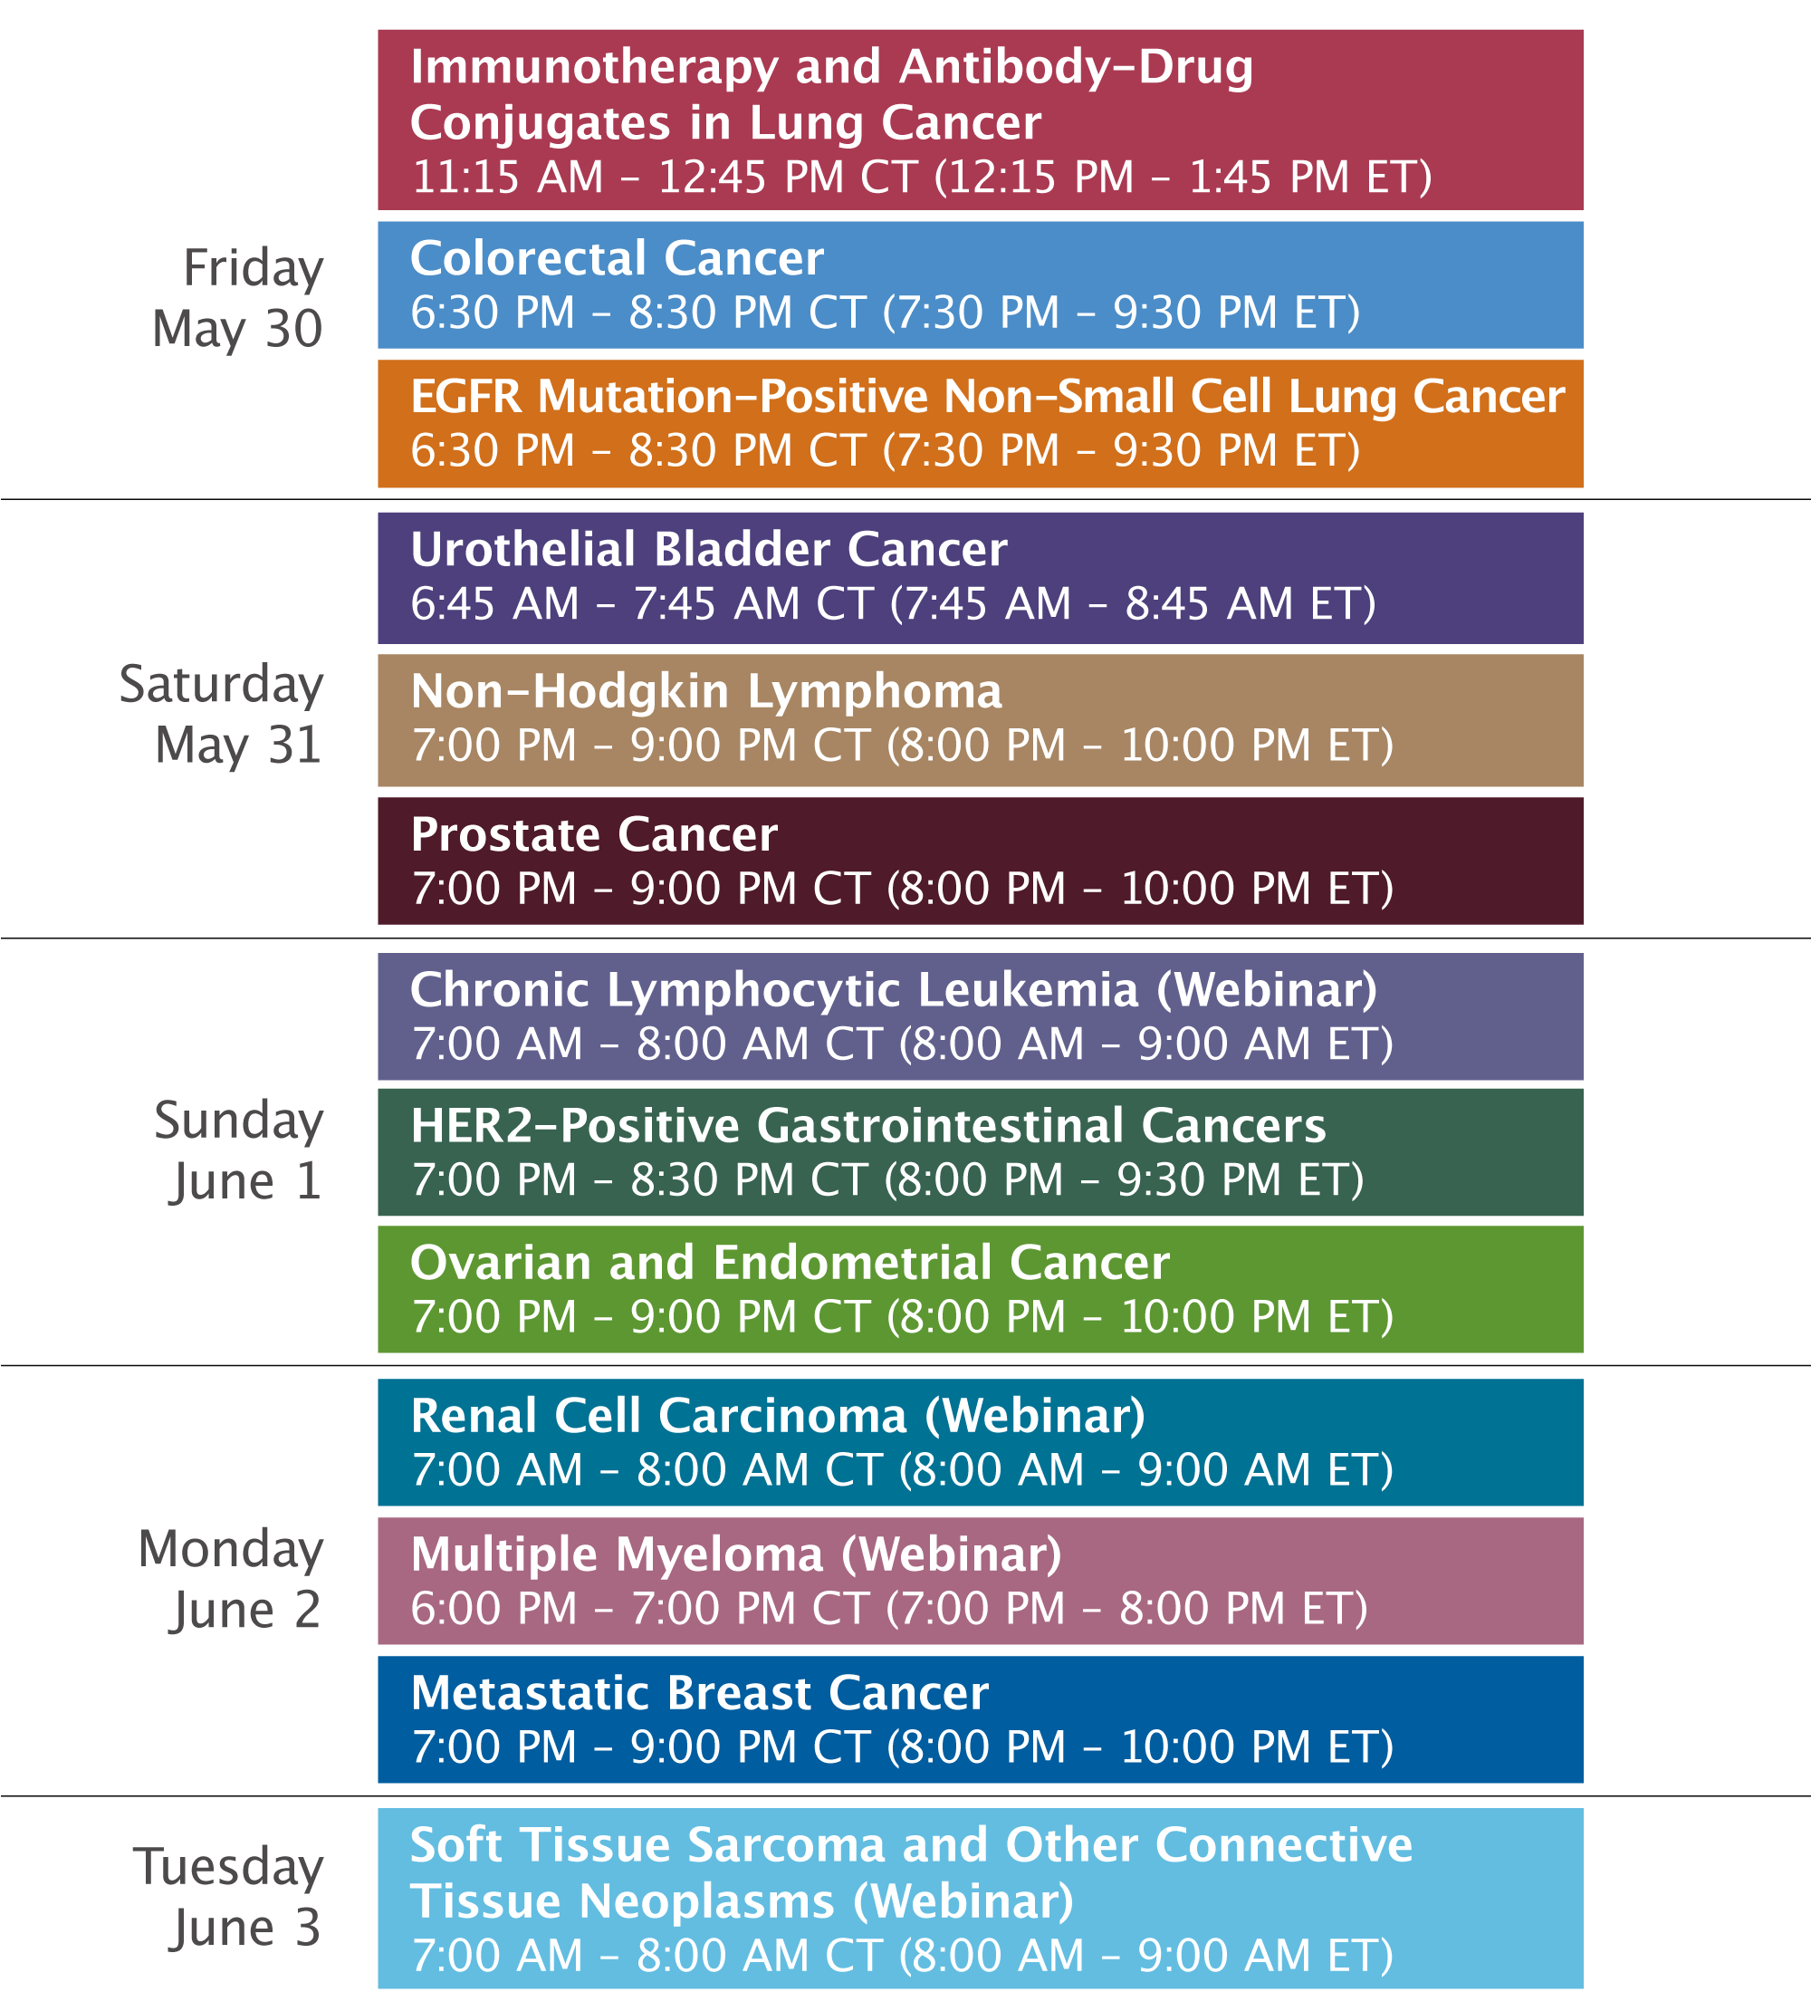

Slide 11



Clinicians in the Meeting Room
Networked iPads are available.
Review Program Slides: Tap the Program Slides button to review speaker presentations and other program content.
Answer Survey Questions: Complete the pre- and postmeeting surveys.
Ask a Question: Tap Ask a Question to submit a challenging case or question for discussion. We will aim to address as many questions as possible during the program.
For assistance, please raise your hand. Devices will be collected at the conclusion of the activity.
Notes:
11

Slide 12

Clinicians Attending via Zoom
Review Program Slides: A link to the program slides will be posted in the chat room at the start of the program.
Answer Survey Questions: Complete the pre- and postmeeting surveys.
Ask a Question: Submit a challenging case or question for discussion using the Zoom chat room.
Get CME Credit: A CME credit link will be provided in the chat room at the conclusion of the program.
Notes:
12

Slide 13
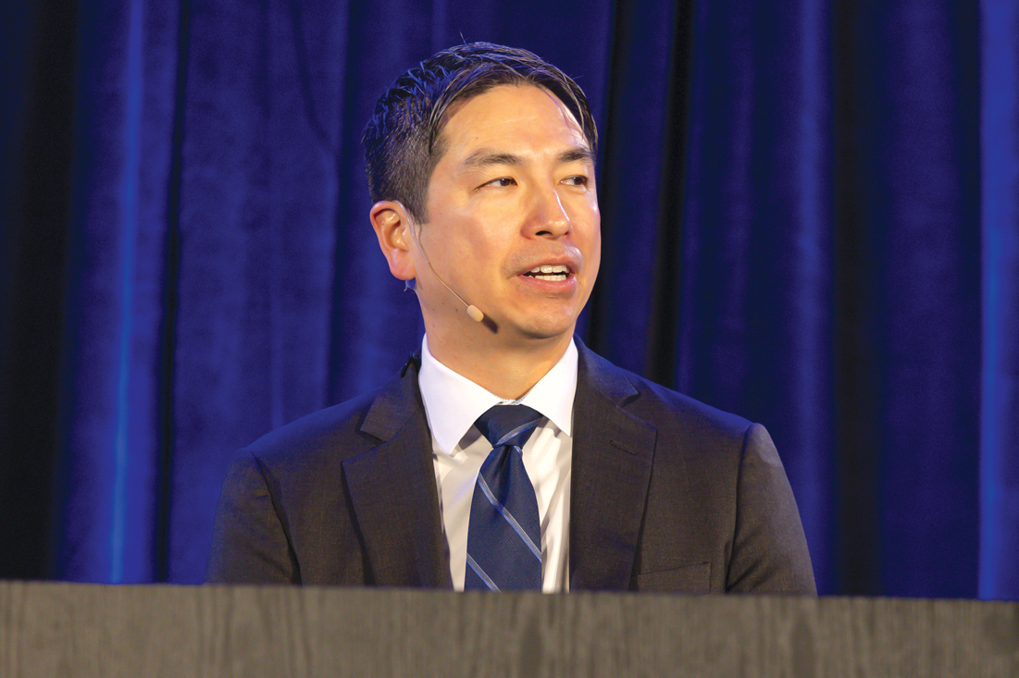
About the Enduring Program
The live meeting is being video
and audio recorded.
The proceedings from today will
be edited and developed into
an enduring web-based program.
An email will be sent to all attendees
when the activity is available.
To learn more about our education programs, visit our website, www.ResearchToPractice.com
Notes:
13
13

Slide 14
Data + Perspectives: Clinical Investigators
Discuss the Current and Future Clinical Care of
Patients with HER2-Positive Gastrointestinal Cancers
Sunday, June 1, 2025
7:00 PM – 8:30 PM CT (8:00 PM – 9:30 PM ET)
Faculty
Haley Ellis, MD
Sara Lonardi, MD
Kanwal Raghav, MD, MBBS
Moderator
Christopher Lieu, MD

Slide 15
Agenda
MODULE 1: Gastroesophageal Cancers — Dr Lonardi
MODULE 2: Biliary Tract Cancers — Dr Ellis
MODULE 3: Colorectal Cancer — Dr Raghav

Slide 16
Agenda
MODULE 1: Gastroesophageal Cancers — Dr Lonardi
MODULE 2: Biliary Tract Cancers — Dr Ellis
MODULE 3: Colorectal Cancer — Dr Raghav

Slide 17




Regione del Veneto
ASCO Gastrointestinal Cancers Symposium
Sunday, June 1, 2025
HER2+ Gastric/GEJ Cancer
Sara Lonardi
Medical Oncology 1
Veneto Institute of Oncology IOV-IRCCS, Padua, Italy
Notes:
17

Slide 18
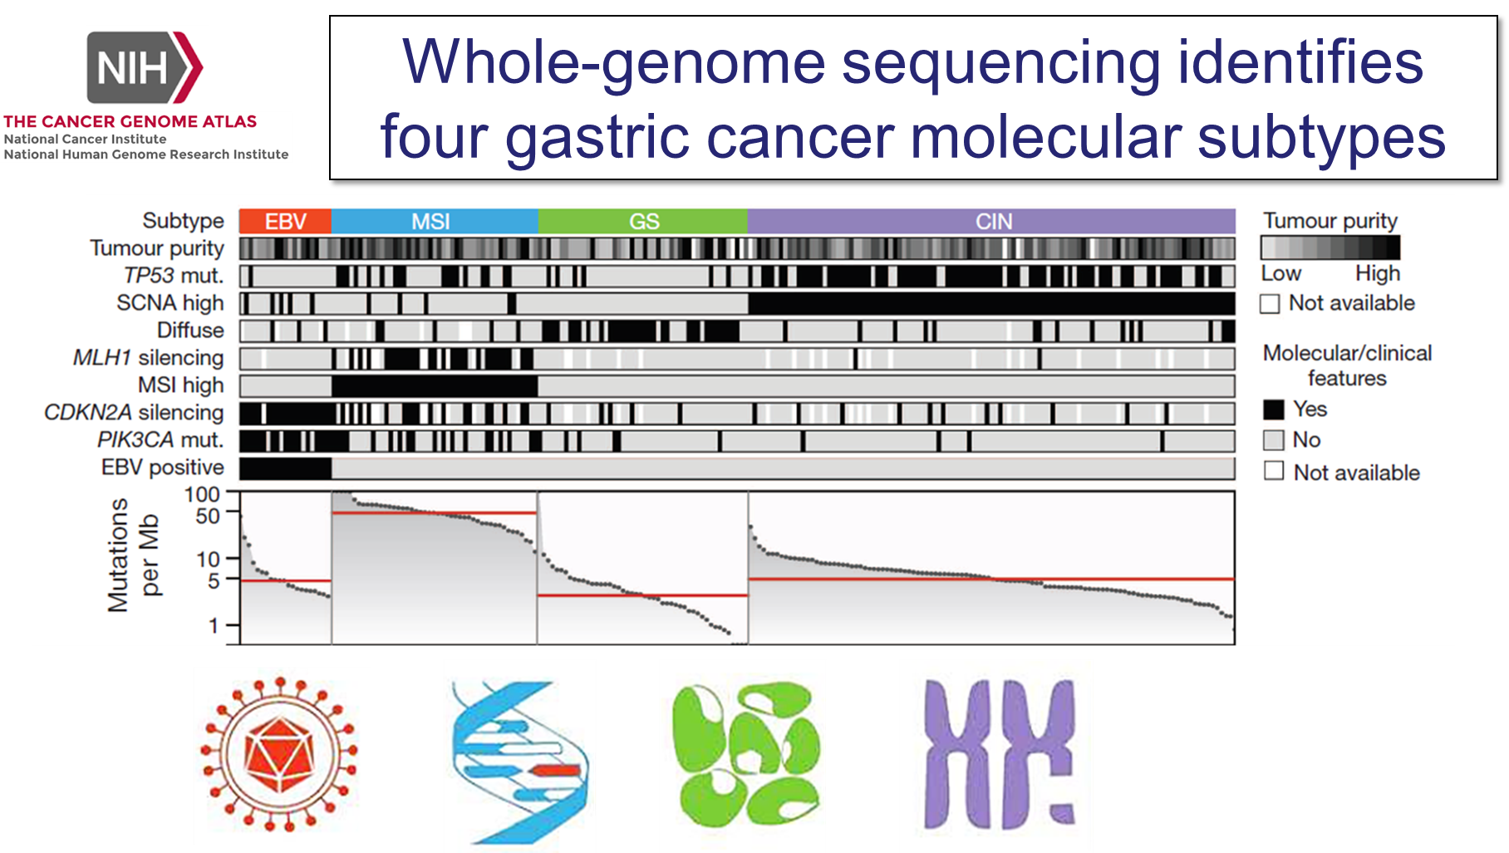
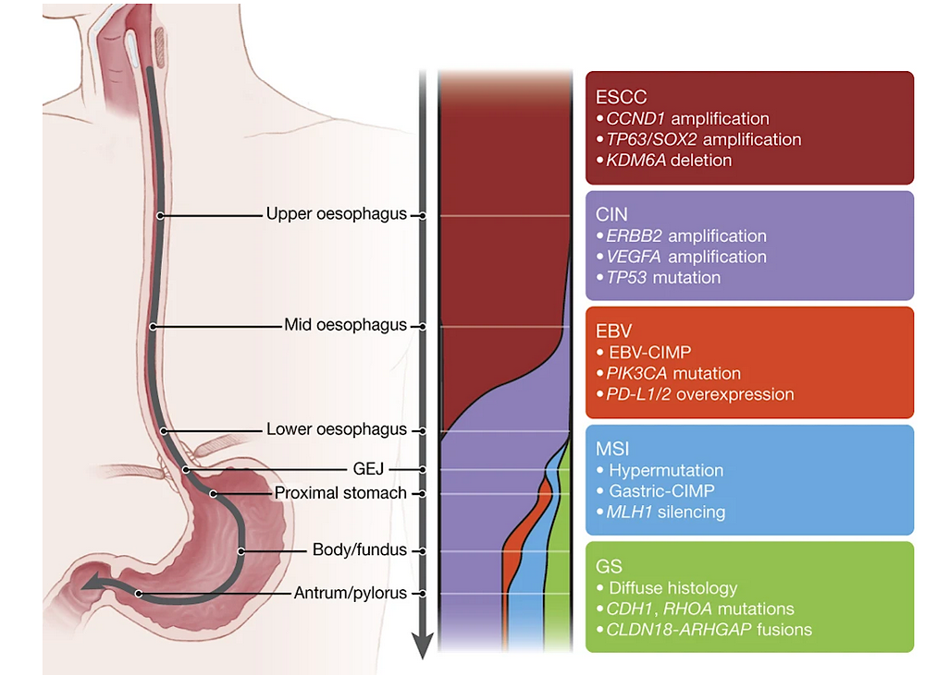
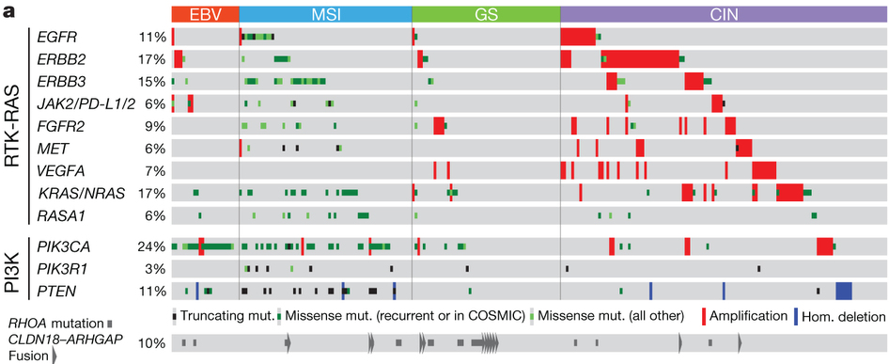
The molecular landscape
HER2 (ERBB2) is the most frequently amplified gene in GC
Cancer Genome Atlas Network – Nature 2017; 169–175

Slide 19
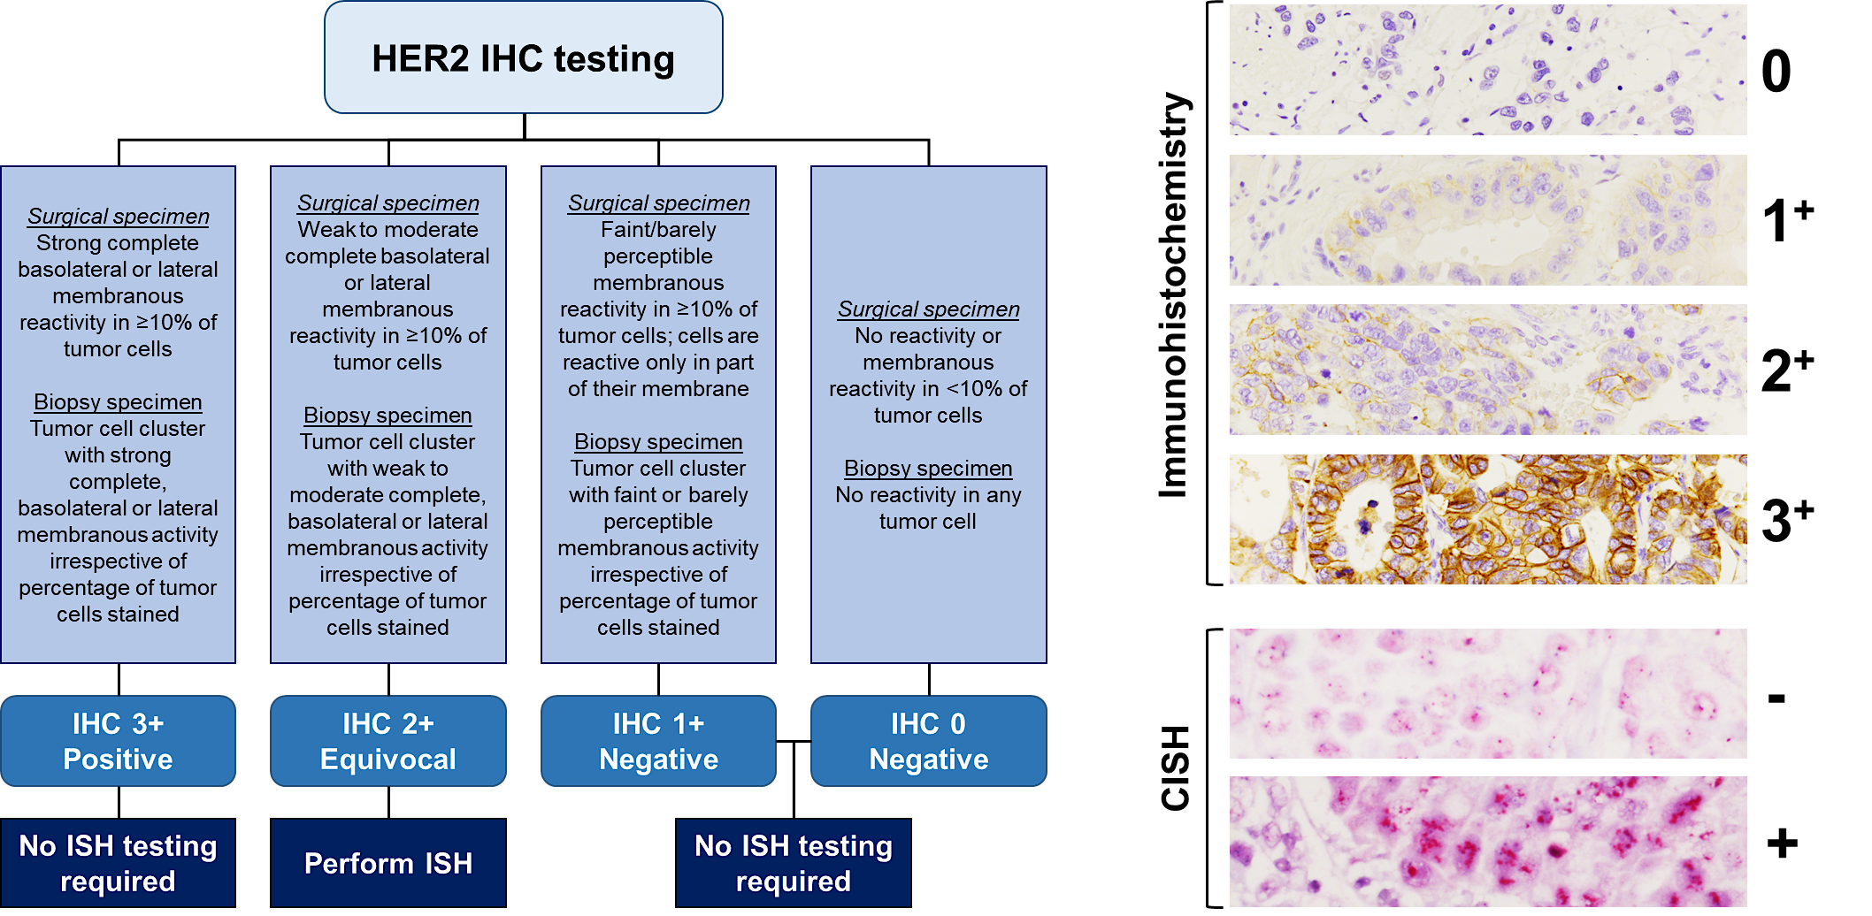
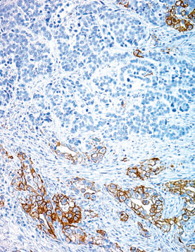
HER2 testing in gastroesophageal cancer
TUMOR HETEROGENEITY
-
+
At least 6 biopsy samples to have a reliable result!
Fassan M et al, Pathologica 2020

Slide 20
HER2 expression as a driver of treatment choice in the last 15 years
HER2 negative
Platin based doublet
HER2 positive (3+/2+ ISH+)
Trastuzumab + platin based doublet

Slide 21
HER2 expression as a driver of treatment choice.. But not alone!
HER2 negative
Platin based doublet+CPI
(according to PD-L1)
HER2 positive (3+/2+ ISH+)
Trastuzumab + platin based doublet

Slide 22

TOGA Trial set the Standard treatment in EGJ
Trastuzumab + Cis/Oxa + 5FU/Cape
mOS: 16.0 months

Slide 23
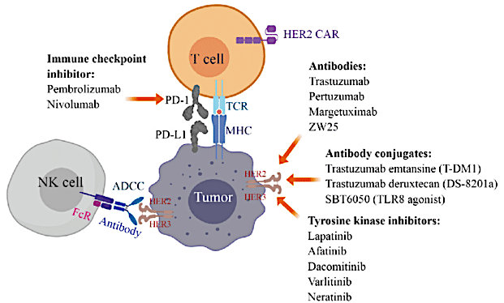
Synergy between HER2 and PD-1 inhibitors
Co-administration of CPI and trastuzumab has been shown to:
- enhance HER2-specific T-cell responses
- promote immune cell trafficking
- induce expansion of peripheral memory T cells
Janjigian Y et al, Nature 2021
Zhao P et al, J Hematol Oncol 2019

Slide 24
The KeyNote 811 trial
Key Eligibility Criteria
Advanced, unresectable G/GEJ adenocarcinoma
No prior systemic therapy in advanced setting
HER2+ by central review (IHC 3+ or IHC 2+ ISH+)
ECOG PS 0 or 1
Pembrolizumab 200 mg IV Q3W +
Trastuzumab and FP or CAPOXª
for up to 35 cycles
R 1:1
N=698
Placebo IV Q3W +
Trastuzumab and FP or CAPOXª
for up to 35 cycles
Stratification Factors
Geographic region
PD-L1 CPS <1 vs CPS ≥1
Chemotherapy choice
Endpoints
Dual primary: OS, PFS
Secondary: ORR, DOR , safety
ªTrastuzumab: 6 mg/kg IV Q3W following an 8 mg/kg loading dose. FP: 5-fluorouracil 800 mg/m² IV on D1-5 Q3W + cisplatin 80 mg/m² IV Q3W. CAPOX: capecitabine 1000 mg/m² BID on D1-14 Q3W + oxaliplatin 130 mg/m² IV Q3W. PFS, ORR, DOR per RECIST by BICR.
https://clinicaltrials.gov/study/NCT03615326. Accessed Feb 2024

Slide 25
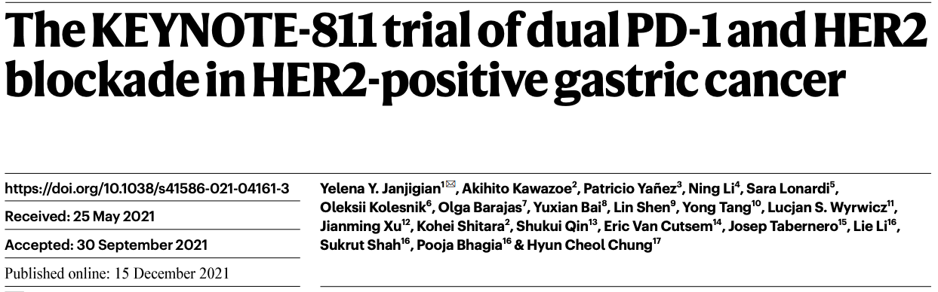
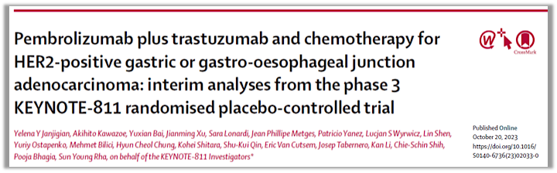

Slide 26
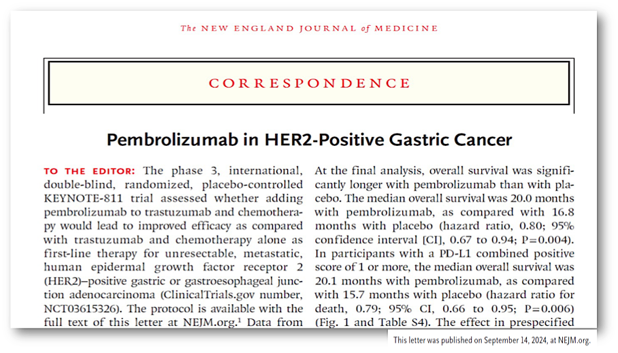

Slide 27
Progression-free and Overall Survival at Final Analysis (ITT)
Data Cut-off 20 March 2024
Notes:
Blinded independent central review 9 months after last patient randomized

Slide 28
Antitumor Activity in PD-L1 CPS ≥1 Subgroup at Final Analysis
OS
PFS
ORR and DOR
 | Events, n (%) | Median (95% CI), mo
Pembrolizumab group | 226 (76%) | 20.1 (17.9-22.9)
Placebo group | 244 (82%) | 15.7 (13.5-18.5)
 | Events, n (%) | Median (95% CI), mo
Pembrolizumab group | 221 (74%) | 10.9 (8.5-12.5)
Placebo group | 226 (76%) | 7.3 (6.8-8.4)
 | Responders, n | Median DOR (range), mo
Pembrolizumab group | 218 | 11.3 (1.1+ -to 60.8+)
Placebo group | 173 | 9.5 (1.4+ to 60.5+)
100
100
HR 0.79 (95% CI, 0.66-0.95)
HR 0.72 (95% CI, 0.60-0.87)
Δ 14.7% (7.1-22.2)
90
12-mo rate
90
12-mo rate
80
69%
80
46%
73.2% (67.7-78.1)
61%
24-mo rate
33%
24-mo rate
70
43%
36-mo rate
70
24%
36-mo rate
CR
58.4% (52.6-64.1)
35%
29%
14%
19%
60
23%
60
11%
OS, %
50
PFS, %
50
PR
CR
40
40
PR
30
30
20
20
10
10
0
0
0
3
6
9
12
15
18
21
24
27
30
33
36
39
42
45
48
51
54
57
60
63
66
0
3
6
9
12
15
18
21
24
27
30
33
36
39
42
45
48
51
54
57
60
63
66
No. at Risk
Months
No. at Risk
Months
Pembrolizumab Group
N = 298
Placebo Group
N = 296
298
265
207
166
127
102
78
59
48
32
5
0
298
200
123
73
60
50
36
28
19
12
2
0
296
244
180
135
104
85
63
50
30
13
3
0
296
152
78
45
29
23
19
14
13
6
2
0
Data cutoff date: 20 Mar 2024. DOR, duration of response.

Slide 29

PD-L1
!

Slide 30
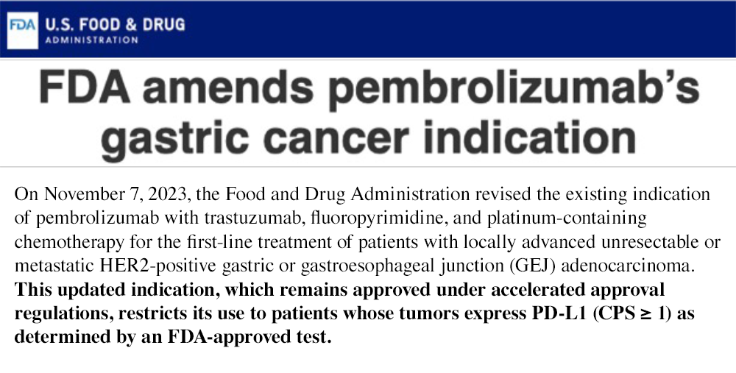
Regulatory agencies approval
Notes:
Pembrolizumab plus trastuzumab and chemotherapy provided meaningful improvement in PFS and ORR, particularly in dual HER2 and PD-L1 overexpressed tumors:
- PFS: 10.9 vs 7.3 mo, HR 0.71: ORR: 73% vs 58%; OS: 20 vs 15.7 mo, HR 0.81 in CPS ≥1 population
- 73% ORR, resulting in a statistically significant, clinically meaningful 13% absolute improvement in ORR compared with placebo plus trastuzumab and chemotherapy
- Deeper and more durable responses
- AE incidence was similar between arms, with no new safety concerns identified
These data resulted in approval of pembrolizumab, trastuzumab plus chemotherapy as first-line therapy in patients with advanced unresectable or metastatic gastroesophageal cancer with HER2 and PD-L1 overexpression in US and Europe

Slide 31

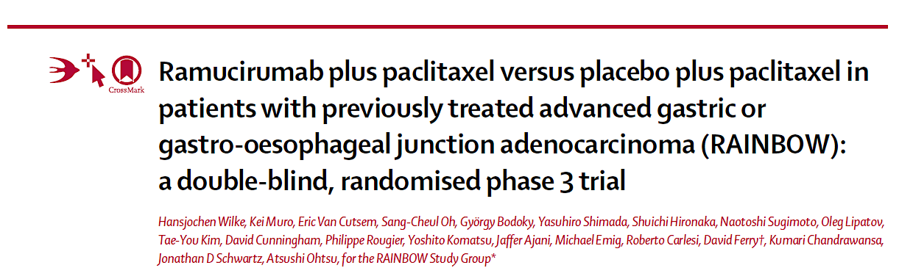
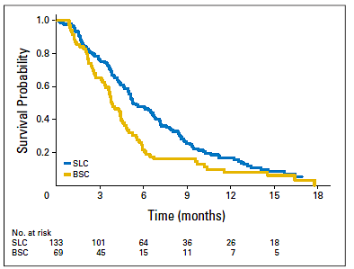
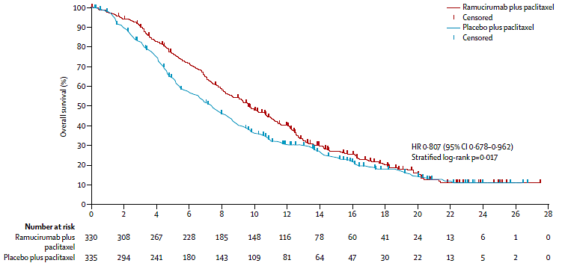
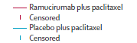
Second-line CT is effective in aGC
 | RAM+PTX | PBO+PTX
Patients / Events | 330 / 256 | 335 / 260
Median (mos) (95% CI) | 9.6 (8.5, 10.8) | 7.4 (6.3, 8.4)
Wilke et al. Lancet Oncology 2014

Slide 32
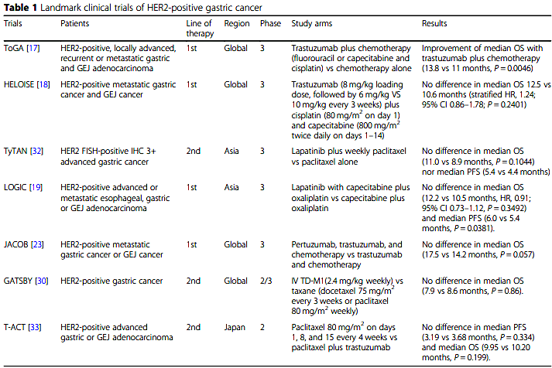
Landmark clinical trials of HER2-positive gastric cancer
✓
✗
✗
✗
✗
✗
✗
Zhao P et al, J Hematol Oncol. 2019;12(1):50

Slide 33
Can we further improve? Issues impacting on outcome
- Tumor heterogeneity
- Acquired resistance
- Low expression

Slide 34
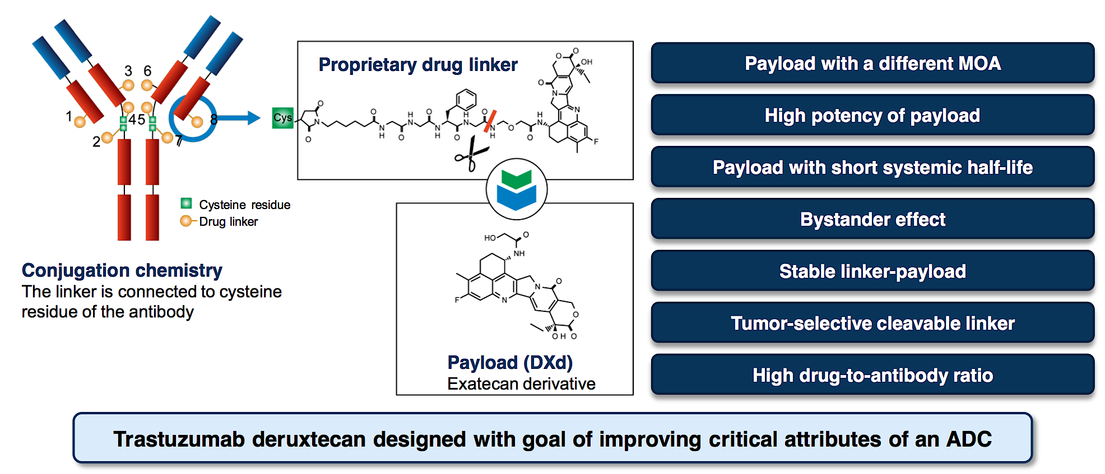
Trastuzumab Deruxtecan characteristics
Novel, next-generation, HER2-directed antibody-drug conjugate composed of
- humanized monoclonal antibody targeting HER2
- cleavable tetrapeptide-based linker
- potent topoisomerase I inhibitor payload (DXd)

Slide 35
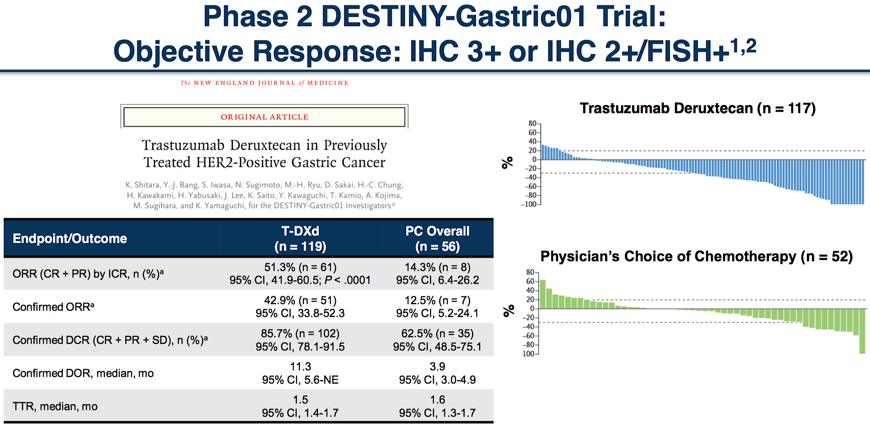
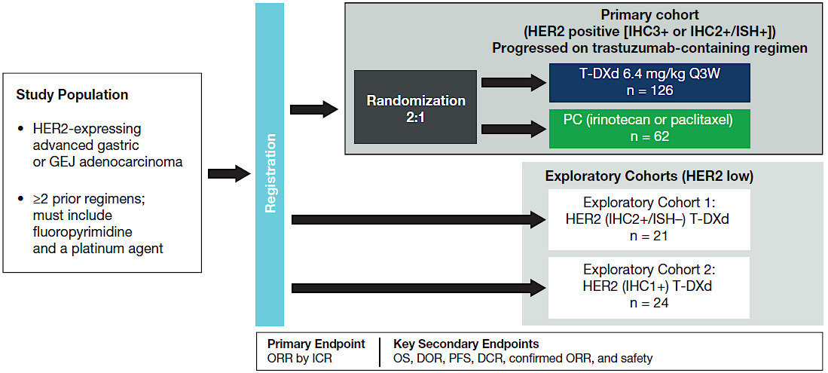
Phase 2 DESTINY-Gastric 01 trial
Shitara et al, New Engl J Med 2020

Slide 36

Phase 2 DESTINY-Gastric 01 trial
Shitara et al, New Engl J Med 2020

Slide 37
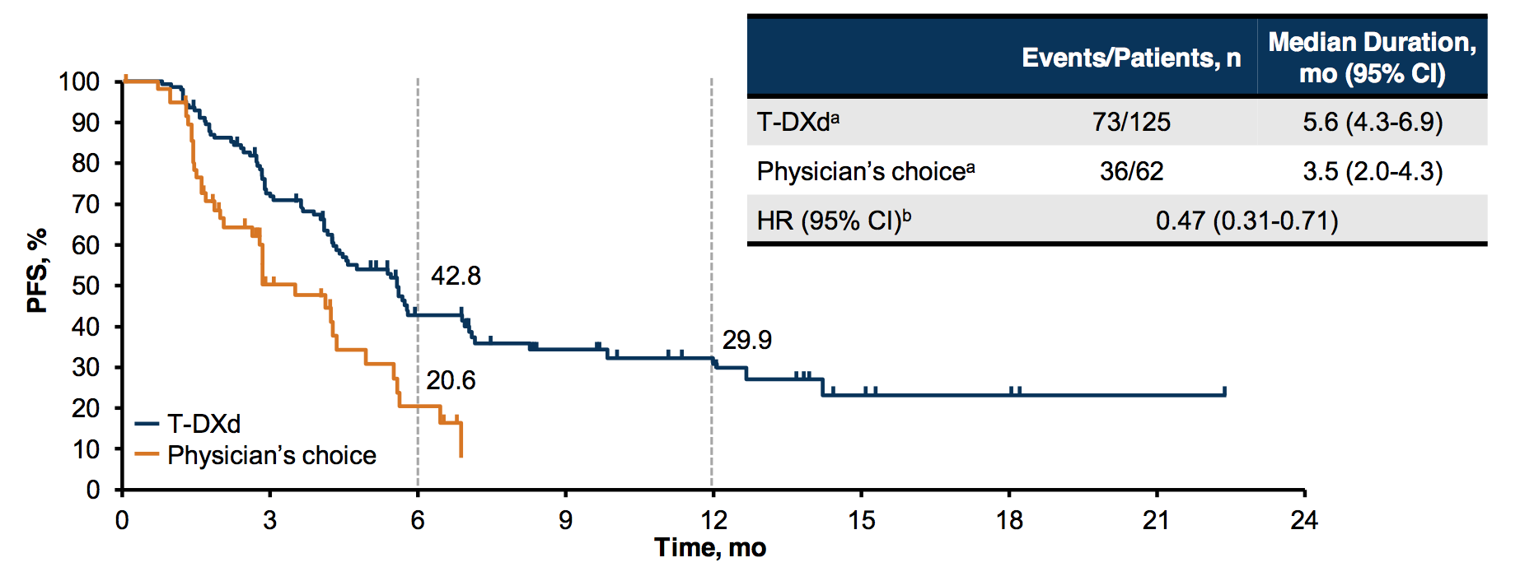
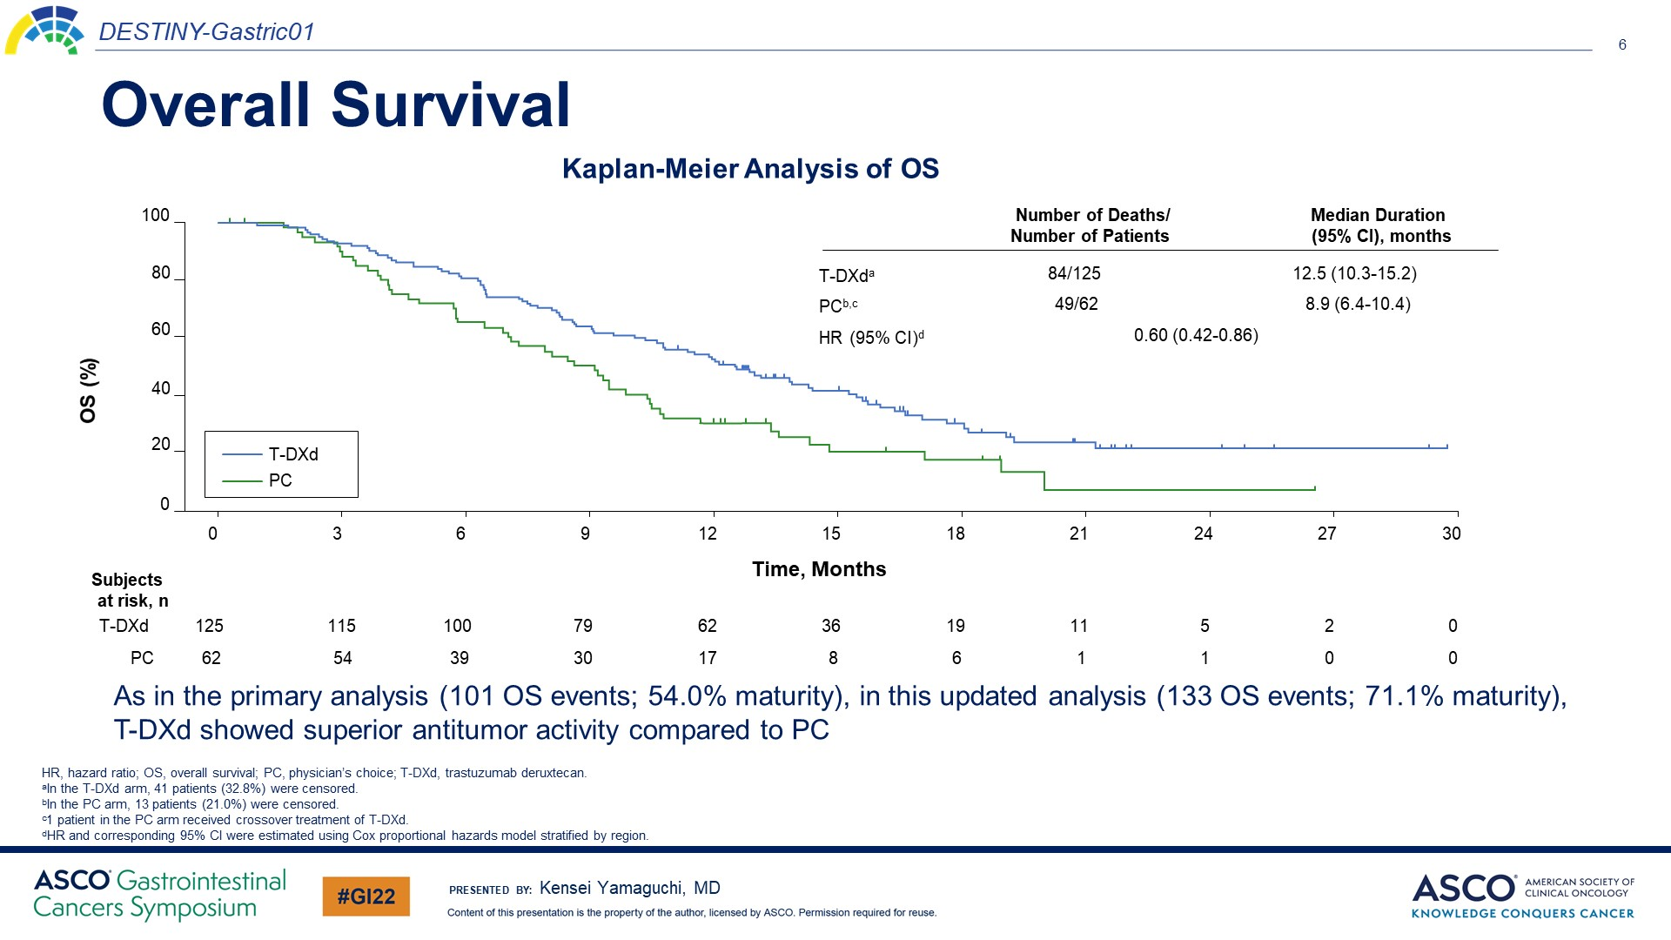
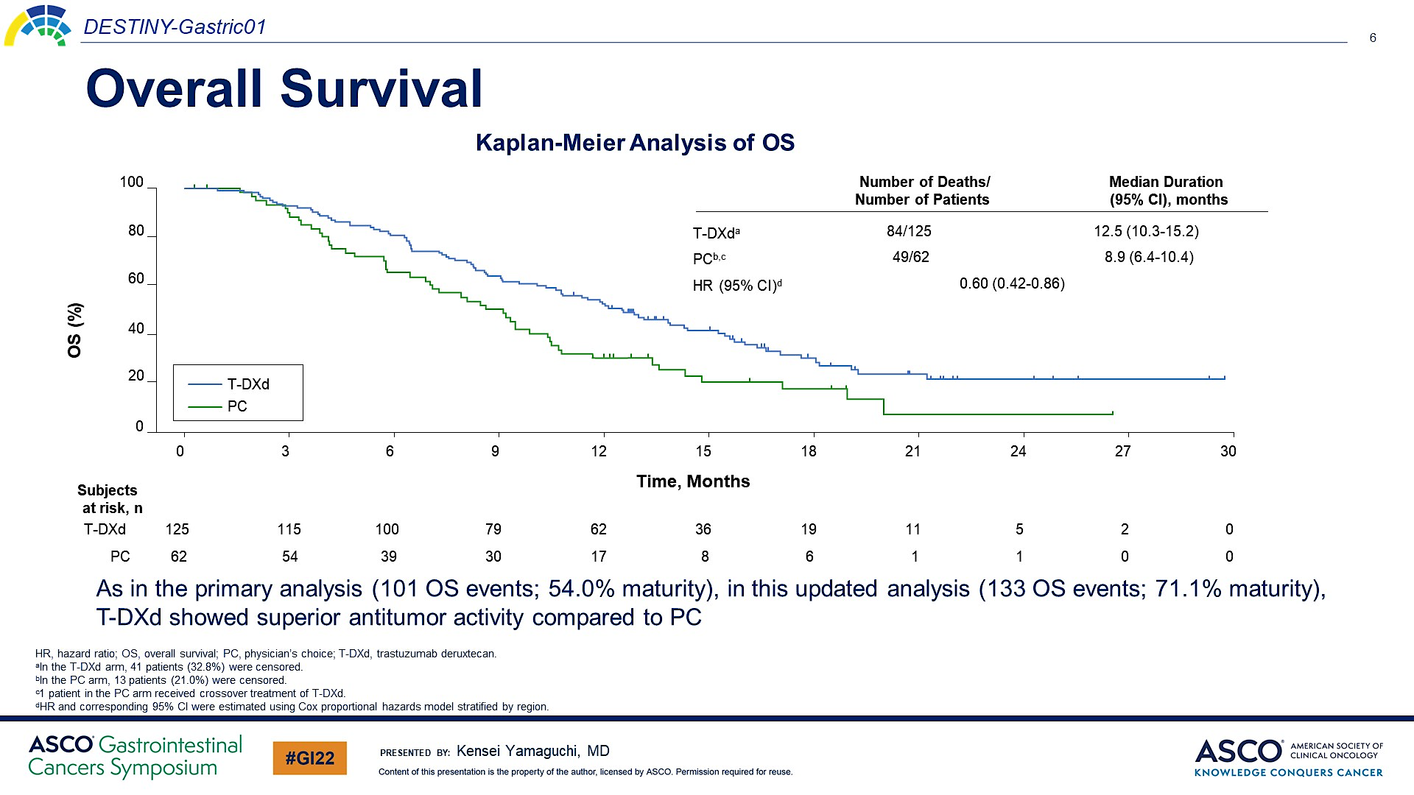
DESTINY-Gastric01 trial: PFS and OS
Shitara et al, New Engl J Med 2020
Yamaguchi et al, ASCO GI 2022

Slide 38
Notes:
patients with alterations in key signal transduction genes (MET, EGFR, FGFR2 or PIK3 GoF) had numerically lower ORR. There were trends for worse outcomes in patients with MET, EGFR and FGFR2 amplification; however, interpreta- tion is limited by the small number of patients with these alterations and the lack of a control arm in our study. It remains unknown whether these trends are related to resistance to T-DXd or are simply prognostic effects.

Slide 39
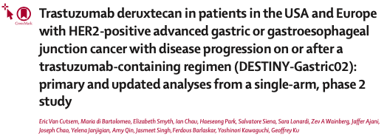
Phase 2 DESTINY-Gastric 02 trial
Van Cutsem et al , Lancet Oncol 2023

Slide 40
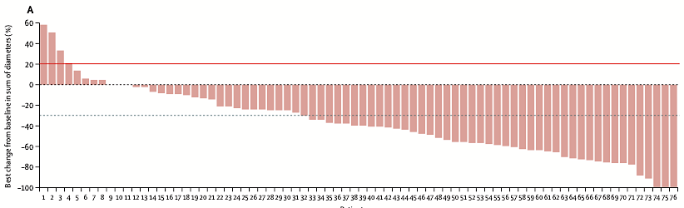
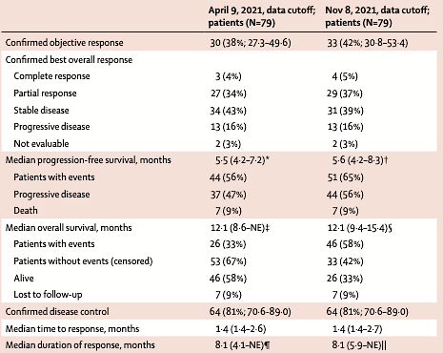
Phase 2 DESTINY-Gastric 02 trial
Van Cutsem et al , Lancet Oncol 2023

Slide 41
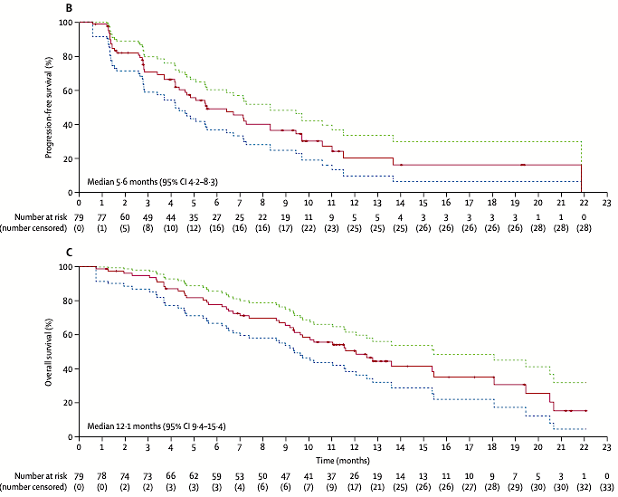
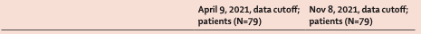
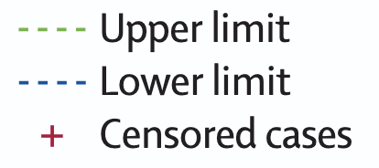
Phase 2 DESTINY-Gastric 02 trial
Van Cutsem et al , Lancet Oncol 2023

Slide 42
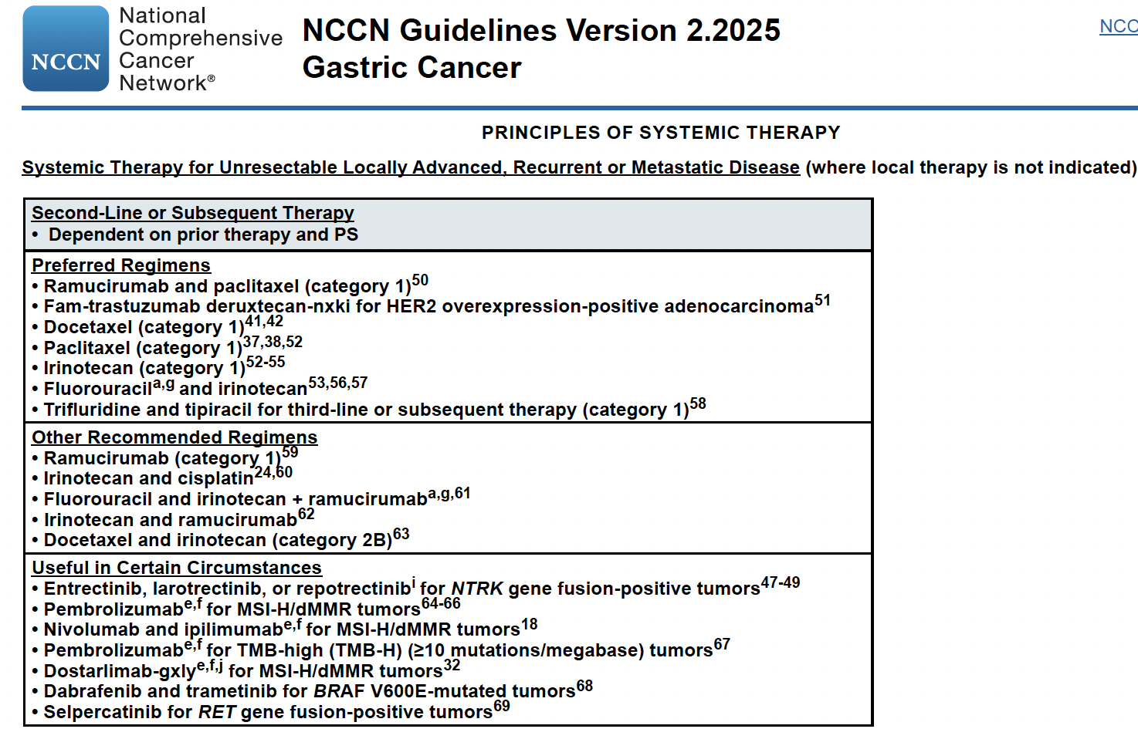

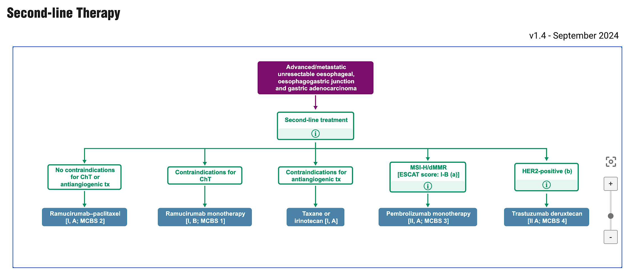
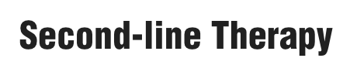
What do the guidelines say?

Slide 43
DESTINY Gastric-04: phase 3 Study of 2L T-DXd vs Ram-PTX

Slide 44
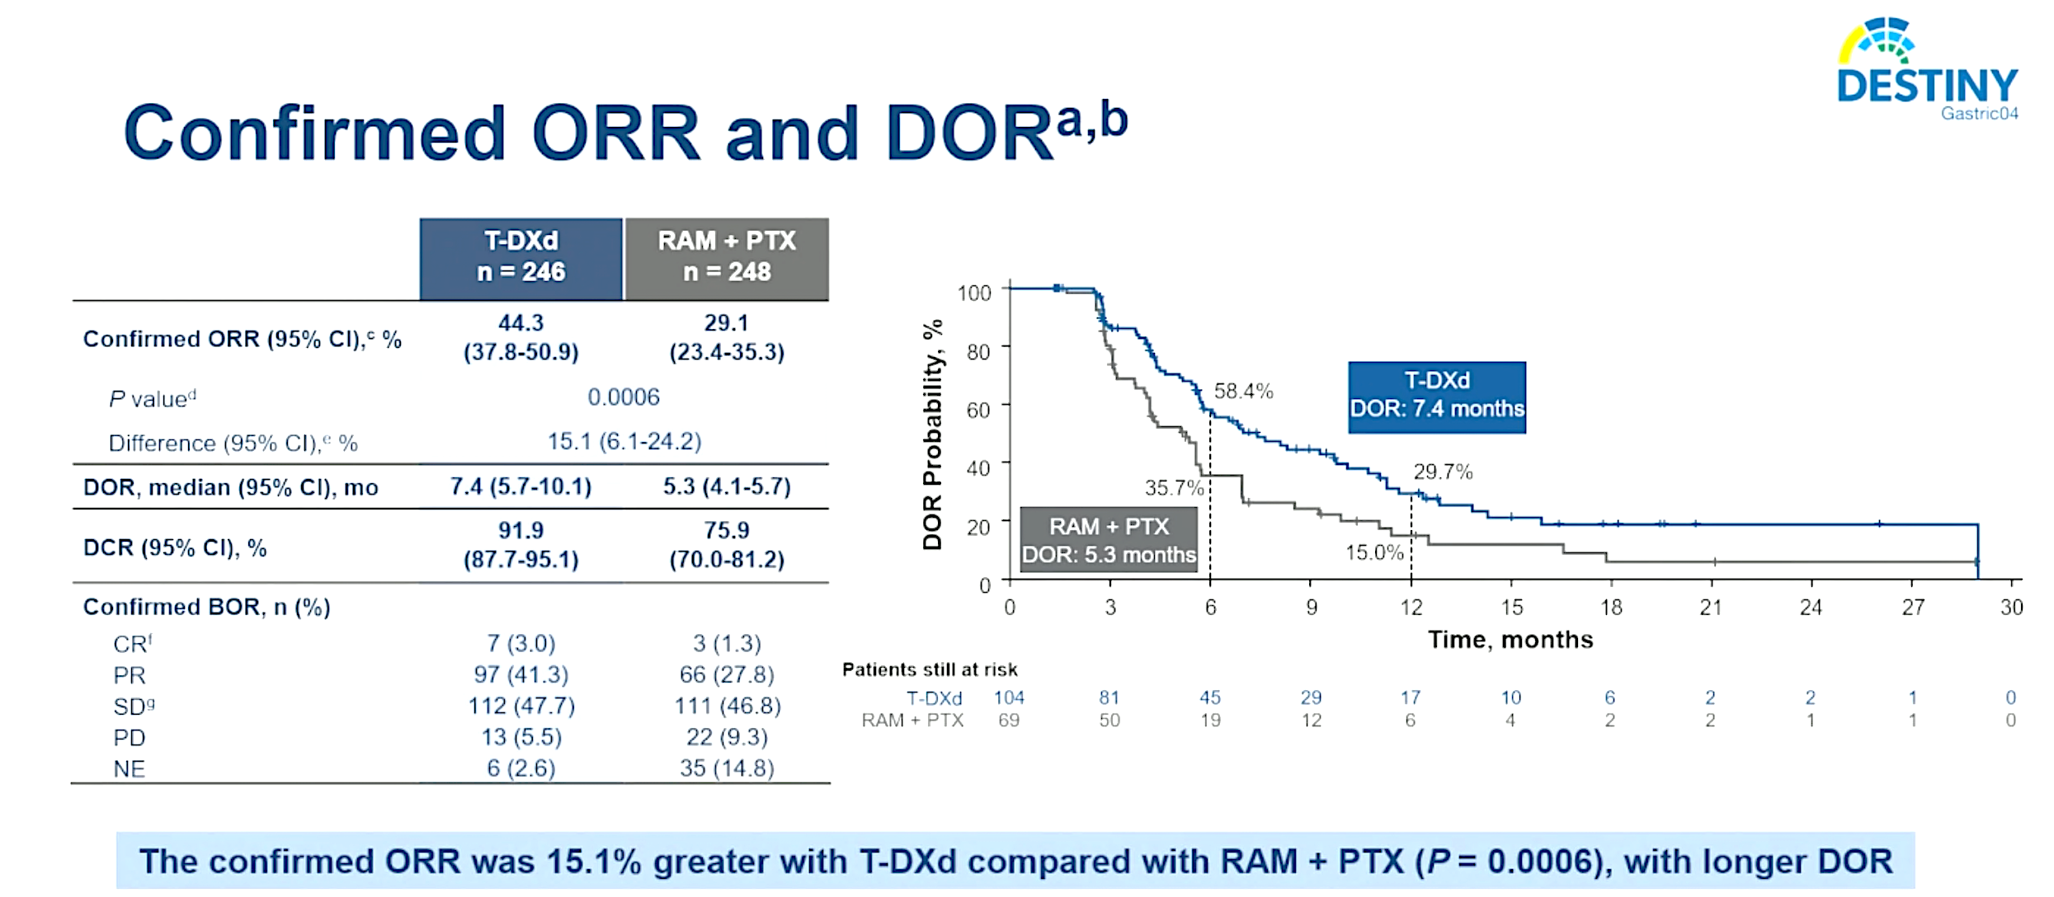
DESTINY-Gastric04: Phase 3 Study of T-DXd in Patients in the 2L Setting
Shitara K et al. ASCO 2025;Abstract LBA4002.

Slide 45
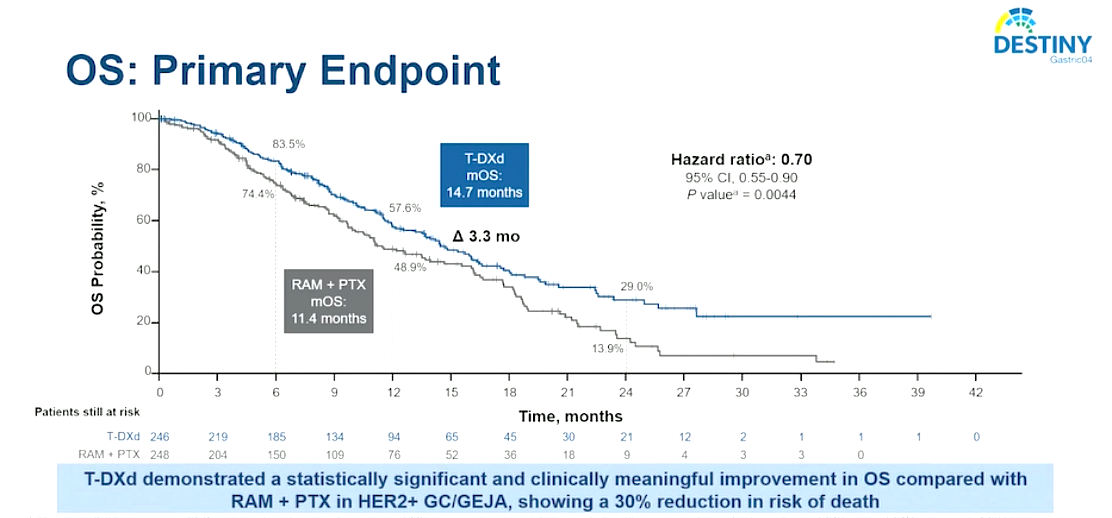
DESTINY-Gastric04: Phase 3 Study of T-DXd in Patients in the 2L Setting
Shitara K et al. ASCO 2025;Abstract LBA4002.

Slide 46
DESTINY-Gastric03 Platform: study update

Slide 47
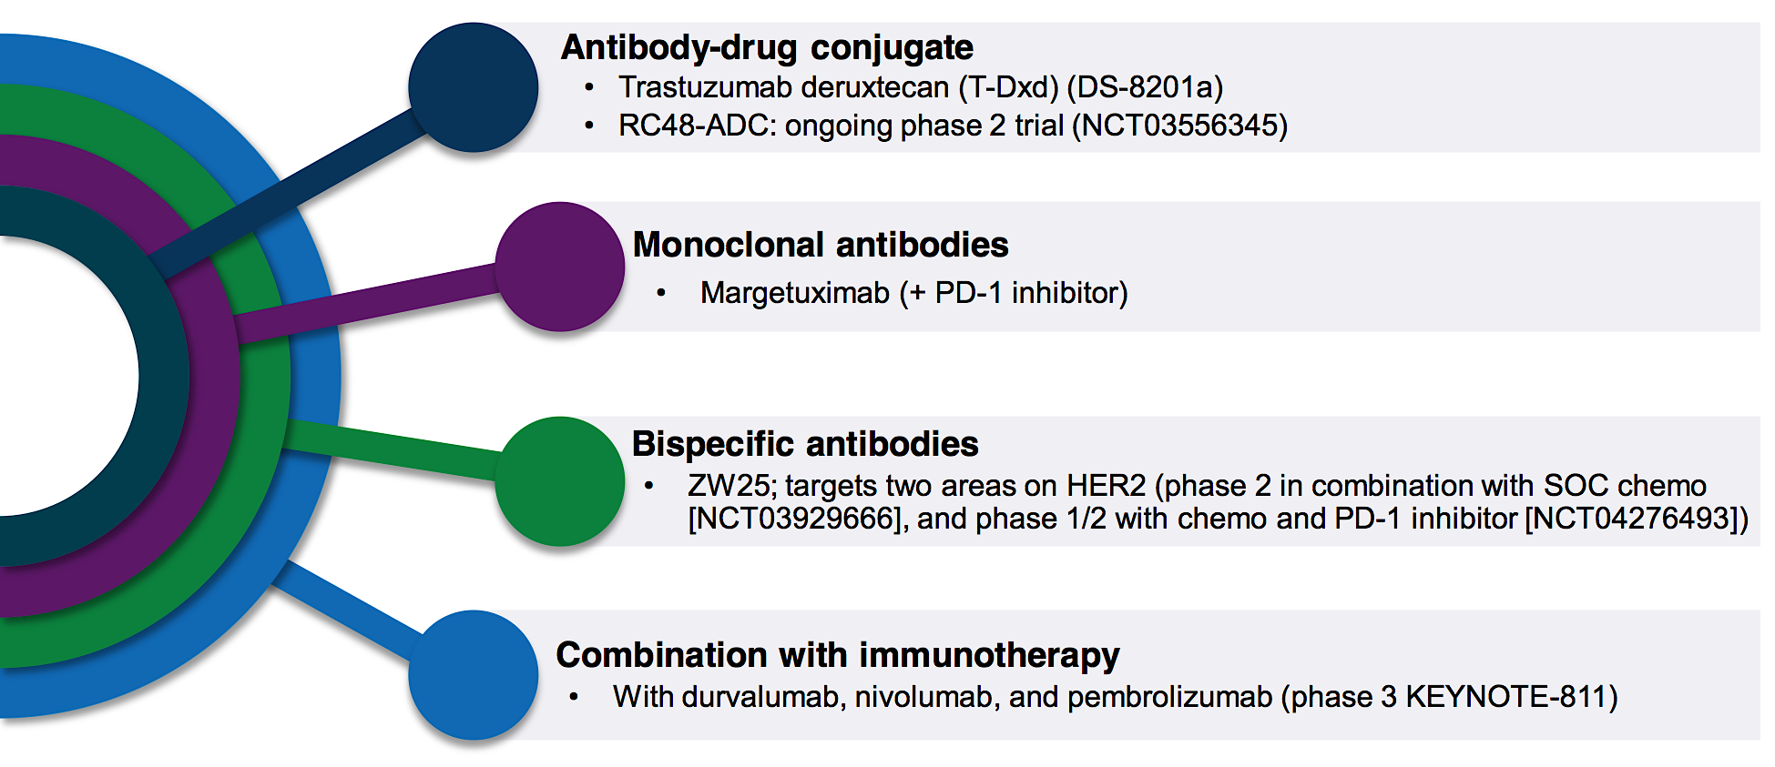
Novel HER-2 directed therapies

Slide 48
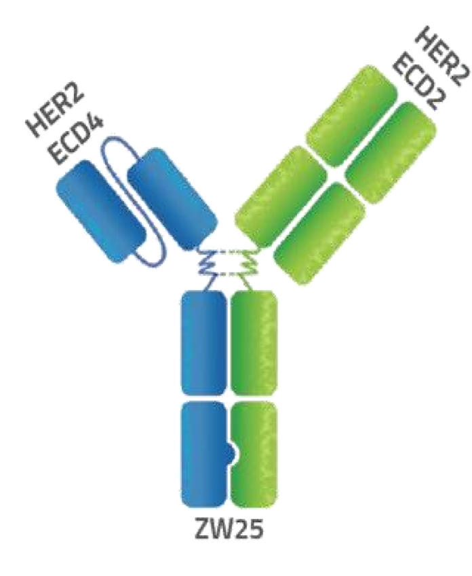
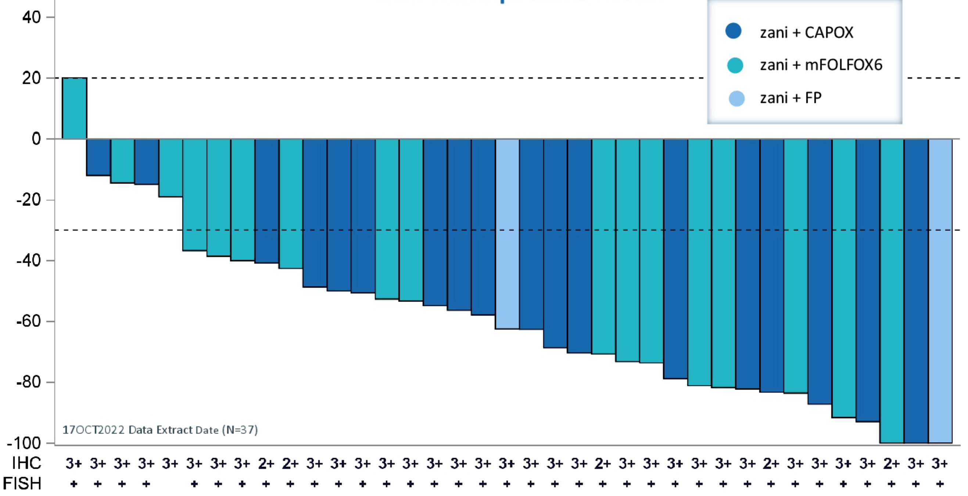

Zanidatamab: a HER2 targeted bispecific antibody
Elimova et al, ASCO GI 2023
Elimova et al, ASCO GI 2023

Slide 49
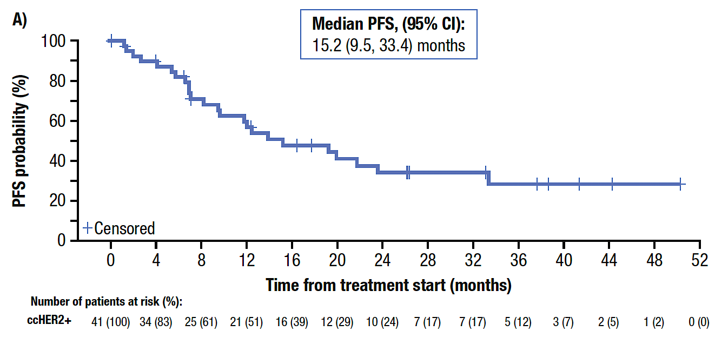
Phase II Study of First-Line Zanidatamab and Chemotherapy for HER2-Positive Advanced GEJ Cancers – PFS
ccHER2+ = centrally confirmed HER2-positive
Elimova E et al. ESMO 2024;Abstract 3212.

Slide 50
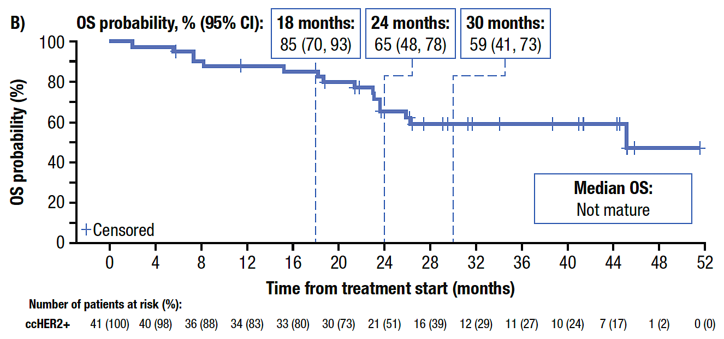
Phase II Study of First-Line Zanidatamab and Chemotherapy for HER2-Positive Advanced GEJ Cancers – OS
Elimova E et al. ESMO 2024;Abstract 3212.

Slide 51
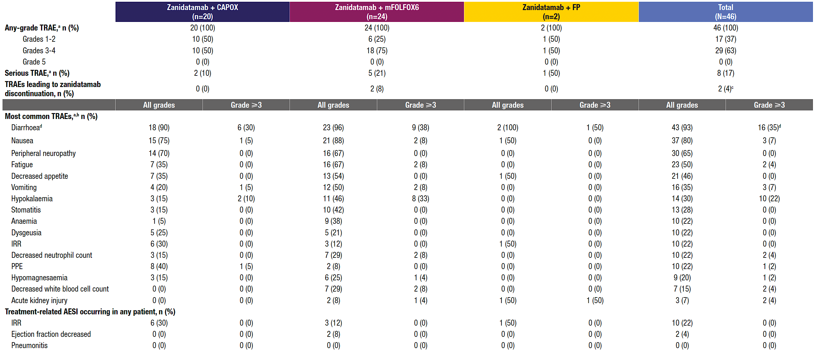
Phase II Study of First-Line Zanidatamab and Chemotherapy – Safety
TRAE = treatment-related adverse event; IRR = infusion-related reaction;
AESI = adverse event of special interest
Elimova E et al. ESMO 2024;Abstract 3212.

Slide 52
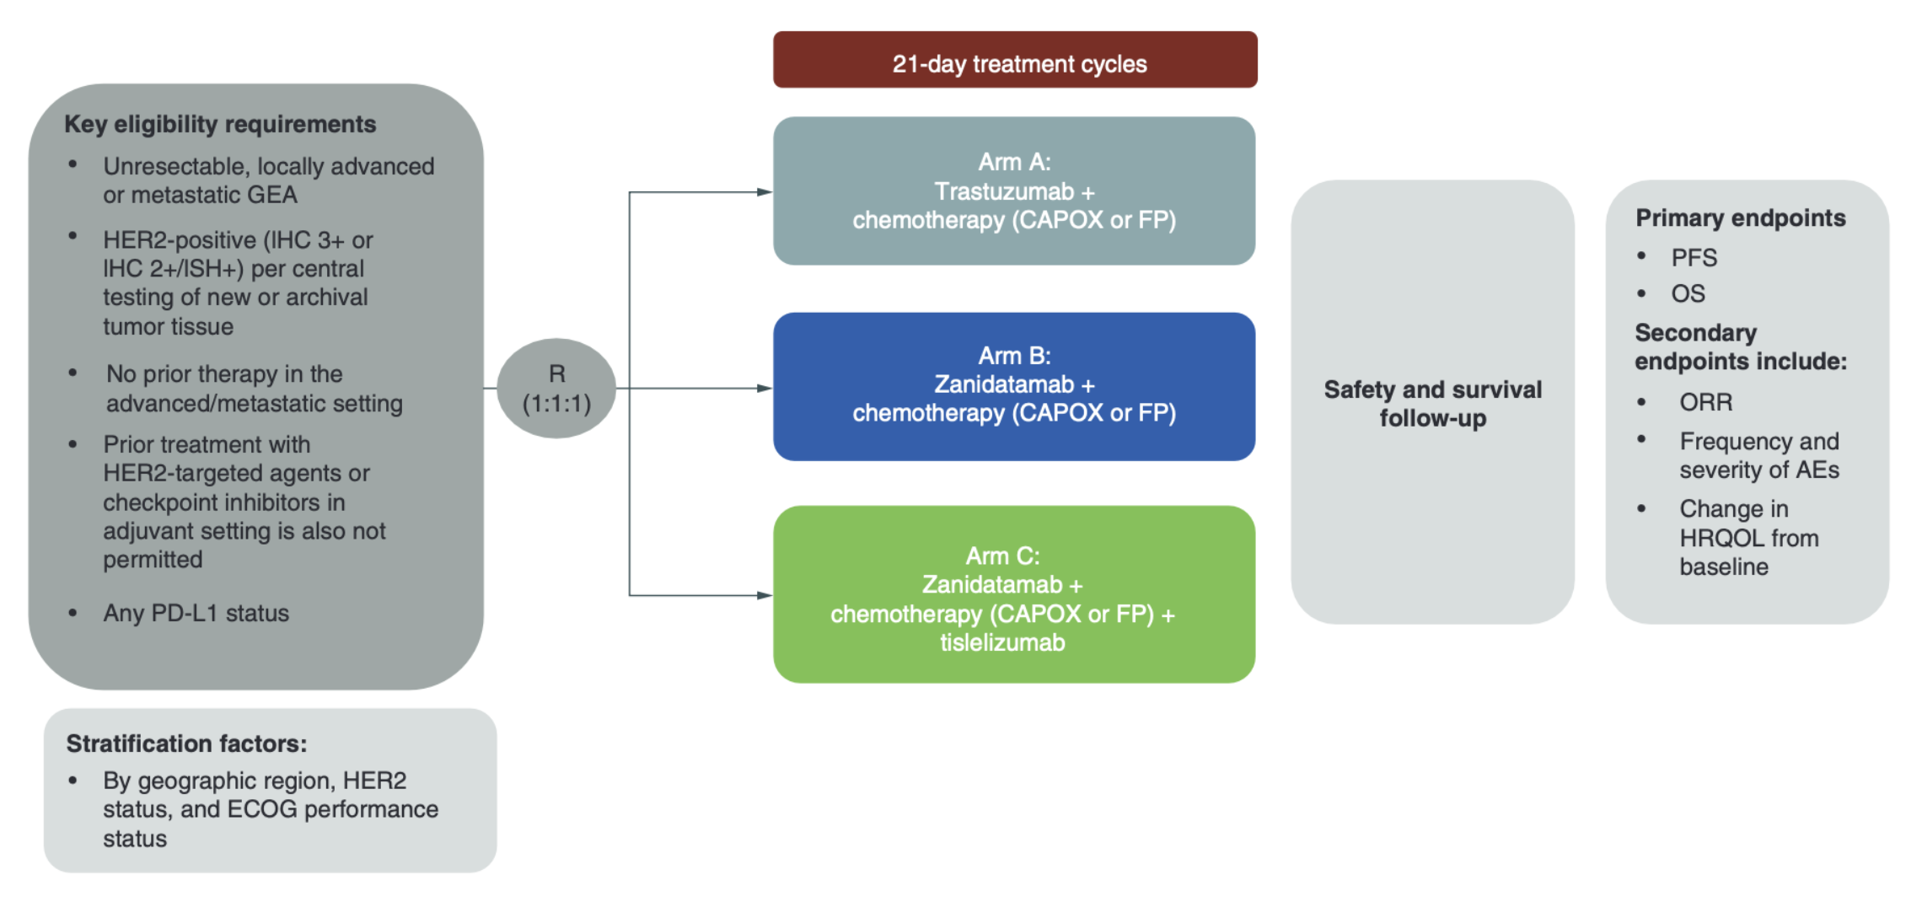
Zanidatamab in mGC first line treatment: the Herizon GEA-01 Trial
Tabernero et al. Future Oncology 2022

Slide 53
Conclusions
Platin-based doublet chemotherapy plus trastuzumab and pembrolizumab is the new standard first line treatment for HER2 positive, PD-L1 >1 advanced gastric cancer
HER2-targeted therapy may lead to reduction in HER2 expression and emergence of other genetic alterations, therefore rebiopsy should be considered (but is not mandatory) after disease progression on trastuzumab
Trastuzumab deruxtecan is the standard second line treatment for HER2 positive advanced gastric cancer
Other HER2 inhibitors are under investigation

Slide 54
Faculty Case Presentations

Slide 55

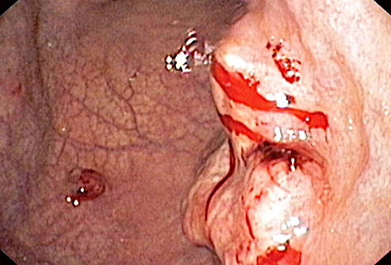



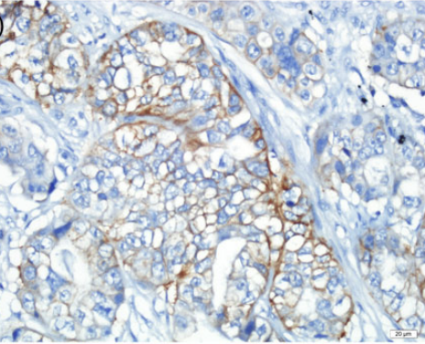
Patient Characteristics and Diagnosis
AGE: 51 y.o.
GENDER: Female
ALLERGIES: None
PS (ECOG) 0
LOCATION: Italy
2019
COMORBIDITIES: None
Symptoms:
weight loss & dyspepsia
CT scan:
Stomach wall thickness and multiple abdominal lymphadenopathies
Gastroscopy:
Sub-cardial lesion
H.E.:
Gastric adenocarcinoma, G3
MSS (IHC), HER2 3+ (IHC)

Slide 56

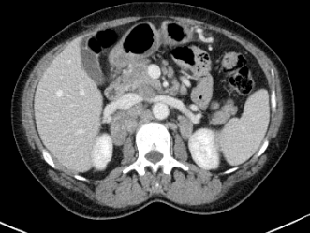

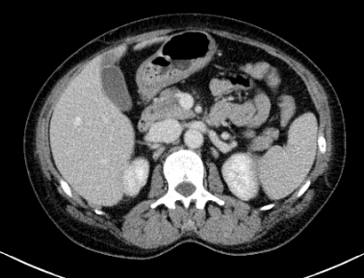
Treatment
November 2019 – March 2020
Keynote 811: Pembrolizumab/Placebo + Trastuzumab + cisplatin-FU
q3w, for 6 cycles
March 2020 – May 2020
Keynote 811: Pembrolizumab/Placebo + Trastuzumab + FU
q3w, for 3 cycles
May 2020
Fever, hypotension -> Hospitalization in Oncology
BR: RP

Slide 57
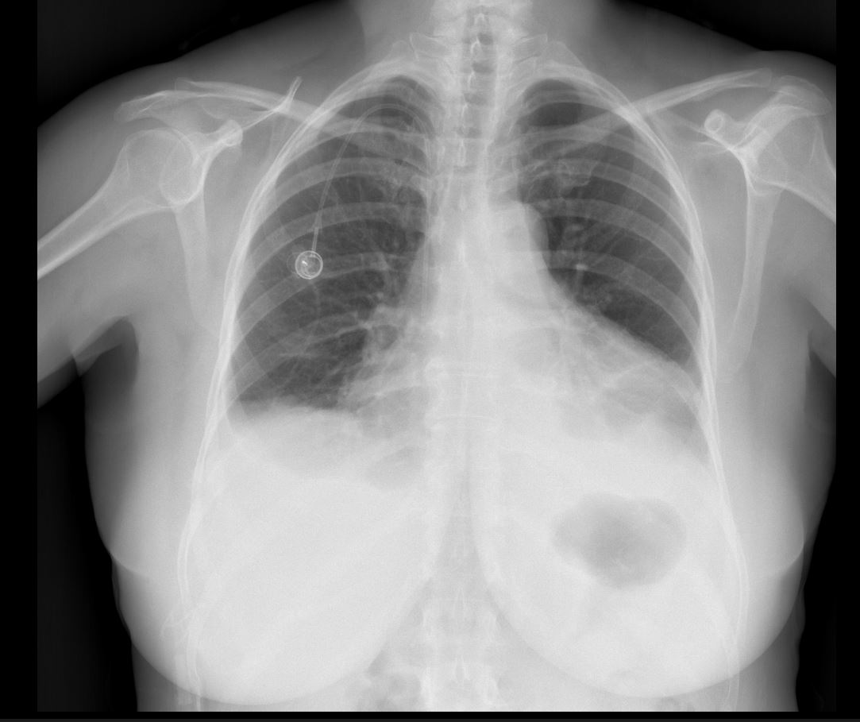
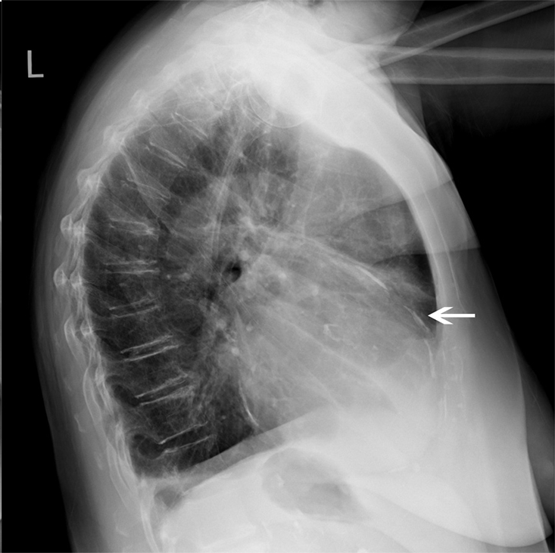
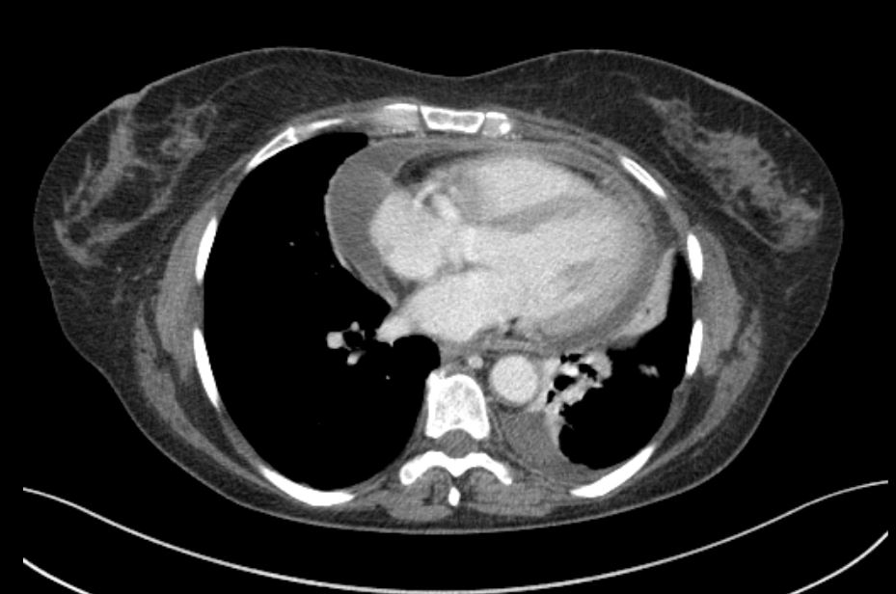
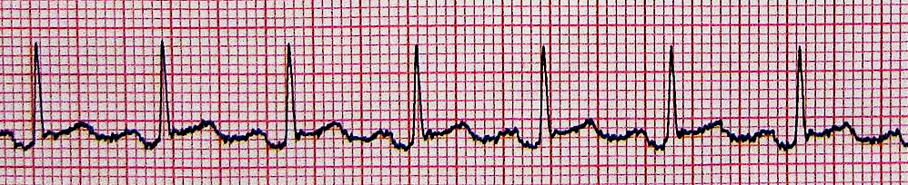


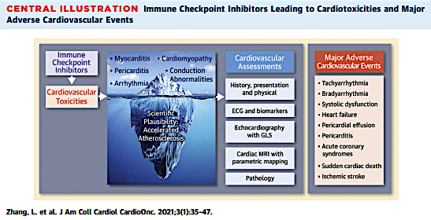

Immune-related toxicity
fever
hypotension
tachycardia (120-130 bpm, RS)
desaturation (SpO2 87%)
NEGATIVE
Immune-related Pericarditis
Colchicine
Prednisolone 1 mg/kg die
Ibuprofen

Slide 58

Treatment
November 2019 – March 2020
Keynote 811: Pembrolizumab/Placebo + Trastuzumab + cisplatin-FU
q3w, for 6 cycles
March 2020 – May 2020
Keynote 811: Pembrolizumab/Placebo + Trastuzumab + FU
q3w, for 3 cycles
May 2020
Fever, hypotension -> Hospitalization in Oncology Immune-related pericarditis diagnosis
June 2020
Mild Disease Progression: increased T and lymph-nodes, no new lesions
First line treatment interruption
BR: RP

Slide 59
QUESTIONS FOR THE FACULTY
Given the revised indication, do you currently employ pembrolizumab as a component of up-front treatment in HER2-positive advanced gastroesophageal cancer only for patients with PD-L1-positive (CPS ≥1) disease? Are there any clinical situations in which you would be tempted to offer pembrolizumab in the first-line setting for a patient with a PD-L1 CPS <1?
Do you typically reassess HER2 status for patients with HER2-positive advanced gastroesophageal cancers, biliary tract cancers and metastatic CRC after disease progression on first-line therapy? How does it affect your approach to subsequent therapy in patients who lose HER2 positivity in each of these diseases?

Slide 60


Slide 61


Treatments
July 2020
June 2020
First line treatment interruption
July 2020 – February 2021
DESTINY-Gastric02: Trastuzumab-Deruxtecan, q3w, for 11 cycles
nausea G2
vomiting G2
neutropenia G3
Premedication: Aprepitant & Palonosetron

Slide 62
Adverse Reactions Across T-DXd Trials: Nausea and vomiting

Slide 63
NCCN Guidelines®: Acute and Delayed Nausea and Vomiting

Slide 64


Baseline
July 20
From baseline after 12 weeks of T-DXd
Reduction in the LSD of target lesion: 41 %
1st Restaging
September 20
2nd Restaging
October 20

Slide 65
Treatments
July 2020
June 2020
Fever, hypotension -> Hospitalization in Oncology
July 2020 – February 2021
DESTINY-Gastric02: Trastuzumab-Deruxtecan, q3w, for 11 cycles
March 2021
Disease Progression: T and lymphnodes
Oct 2020

Slide 66

Comprehensive Genome Profiling
NO TARGET

Slide 67
Treatments
1st Line: November 2019 – May 2020
MK-3475-811: Pembrolizumab/Placebo + Trastuzumab + FP q3w, for 6 cycles, BR:PR
2nd Line: July 2020 – February 2021
DESTINY-Gastric02: Trastuzumab-Deruxtecan, q3w, for 11 cycles, BR:PR
3rd Line: March 2021 – May 2021
Paclitaxel-Ramucirumab, for 3 cycles, BR:PD
4th Line: June 2021 – September 2021
FOLFIRI, for 8 cycles, BR:SD
2 years OS from 1st line

Slide 68
QUESTIONS FOR THE FACULTY
In which line of therapy are you typically recommending T-DXd for your patients with progressive HER2-positive gastroesophageal cancer? Given the results of the DESTINY-Gastric04 study, are you prioritizing T-DXd as second-line therapy in all cases?
What is your approach to the management of the acute nausea and vomiting associated with T-DXd? How do you manage breakthrough nausea and vomiting despite guideline-directed antiemetic prophylaxis?

Slide 69
QUESTIONS FOR THE FACULTY
How does the mechanism of action of zanidatamab differ from other currently available anti-HER2-targeted therapies?
Based on recent trial results evaluating zanidatamab/chemotherapy as first-line treatment for HER2-positive advanced GEJ cancers, if this regimen were to become available, for which patients would you prioritize its use?
Are you optimistic that the results of the HERIZON-GEA-01 trial will be positive? If so, how do you anticipate these results will impact clinical practice?

Slide 70
Agenda
MODULE 1: Gastroesophageal Cancers — Dr Lonardi
MODULE 2: Biliary Tract Cancers — Dr Ellis
MODULE 3: Colorectal Cancer — Dr Raghav

Slide 71




HER2-Positive Biliary Tract Cancers
(BTC)
Haley Ellis, MD
Hepatobiliary Oncologist | Clinical-Translational Investigator
Massachusetts General Hospital | Harvard Medical School
Tucker Gosnell Center for GI Cancers | Termeer Center for Targeted Therapies & Investigational Cancer Therapeutics

Slide 72

Overview of Presentation
Therapeutic landscape and prevalence of HER2 in advanced BTC
Clinical indications and methods for HER2 testing
HER2-targeted therapies in BTC: efficacy and safety
  Trastuzumab deruxtecan (DESTINY-PanTumor02 and HERB trials)
  Zanidatamab (HERIZON-BTC-01 trial)
  Ongoing phase 3 trials for treatment-naïve patients
Clinical case discussions

Slide 73
Overview of Presentation
Therapeutic landscape and prevalence of HER2 in advanced BTC
Clinical indications and methods for HER2 testing
HER2-targeted therapies in BTC: efficacy and safety
  Trastuzumab deruxtecan (DESTINY-PanTumor02 and HERB trials)
  Zanidatamab (HERIZON-BTC-01 trial)
  Ongoing phase 3 trials for treatment-naïve patients
Clinical case discussions

Slide 74

Chemotherapy + immunotherapy is now standard
first-line treatment of advanced BTC
Durvalumab + gem-cis (n=341)
TOPAZ-1: Oh et al. NEJM Evid 2022 | Oh et al. J Hepatol 2025

Slide 75

Outcomes are poor with second-line chemotherapy
Lamarca et al. Ann Oncol 2014 | ABC-06: Lamarca et al. Lancet Oncol 2021 | Incyte 2023

Slide 76

BTC harbor targetable genomic alterations
Kehmann et al. ESMO Open 2024

Slide 77


HER2 amplification/overexpression spans all BTC subtypes
Intrahepatic cholangiocarcinoma
(iCCA)
~3-5%
Extrahepatic cholangiocarcinoma
(eCCA)
~10-20%
Gallbladder cancer
(GBC)
~15-35%
HER2 positivity is associated with a worse prognosis in advanced BTC
Galdy et al. Cancer Metastasis Rev 2017 | Ayasun et al. Cancers 2023 | Lee et al. ASCO GI 2025 | Soreide et al. Eur J Surg Oncol 2025

Slide 78
Overview of Presentation
Therapeutic landscape and prevalence of HER2 in advanced BTC
Clinical indications and methods for HER2 testing
HER2-targeted therapies in BTC: efficacy and safety
  Trastuzumab deruxtecan (DESTINY-PanTumor02 and HERB trials)
  Zanidatamab (HERIZON-BTC-01 trial)
  Ongoing phase 3 trials for treatment-naïve patients
Clinical case discussions

Slide 79



HER2 testing in BTC: who, when, and how
✅ WHO: All patients with locally advanced or metastatic BTC (GBC, eCCA, iCCA)
✅ WHEN: At diagnosis
    1st line trials!
    Future direction: consider earlier testing for neoadjuvant/perioperative strategies
✅ HOW:
Immunohistochemistry (IHC) 🔬
In situ hybridization (ISH) 🧬
Next-generation sequencing (NGS) 🎯
What it detects
HER2 protein
ERBB2 DNA
ERBB2 DNA
What it indicates
HER2 overexpression
ERBB2 amplification
ERBB2 amplification
Tissue and/or blood-based
Javle et al. Cancer 2016 | Jacobi et al. Oncol Res Treat 2021

Slide 80
HER2 testing in BTC follows gastroesophageal cancer guidelines
Patients with locally advanced or metastatic BTC
HER2 testing using IHC 🔬
Score 0 or 1+
Score 2+
Score 3+
HER2 negative
Inconclusive
HER2 positive
No further testing required
No further testing required
HER2 testing using ISH 🧬
Gene not amplified
Gene amplified
HER2 negative
HER2 positive
Roche Diagnostics

Slide 81

Comprehensive HER2 testing with NGS and IHC is important
~15% discordance between HER2 assessment by NGS vs IHC in BTC
Lee et al. ASCO GI 2025
Notes:
HER2-positive (IHC 3+ or 2+/ISH+) or NGS (amp)
N=389 pts in Korea and US
201 pts with NGS data → 93% HER2 non-amplified → of these, 15% were HER2+ by IHC

Slide 82
Overview of Presentation
Therapeutic landscape and prevalence of HER2 in advanced BTC
Clinical indications and methods for HER2 testing
HER2-targeted therapies in BTC: efficacy and safety
  Trastuzumab deruxtecan (DESTINY-PanTumor02 and HERB trials)
  Zanidatamab (HERIZON-BTC-01 trial)
  Ongoing phase 3 trials for treatment-naïve patients
Clinical case discussions

Slide 83
Evolving treatment landscape in HER2+ BTC
in second-line setting and beyond
 | Treatment | Trial | # BTC pts | Prior HER2 Tx | HER2 Status | ORR | DCR | mDOR (mo) | mPFS (mo) | mOS (mo)
ABC-06¹ 2021 | FOLFOX | Phase 3 | 162 | -- | -- | 5% | 33% | -- | 4.0 | 6.2
MyPathway² 2021 | Trastuzumab + Pertuzumab | Phase 2a | 39 | No | IHC 3+, ISH+, or NGS Amp | 23% | 51% | 10.8 | 4.0 | 10.9
KCSG-HB19-14³ 2023 | Trastuzumab + FOLFOX | Phase 2 | 34 | No | IHC 3+, IHC 2+/ISH+, or NGS Amp | 29% | 79% | 4.9 | 5.1 | 10.7
HERIZON-BTC-01⁴ 2023 | Zanidatamab | Phase 2b | 62 80 | No | IHC 3+ IHC 3+ or IHC 2+/Amp | 52% 41% | 79% 69% | 14.9 12.9 | 7.2 5.5 | 18.1 15.5
SGNTUC-019⁵ 2023 | Trastuzumab + Tucatinib | Phase 2 | 30 | No | IHC 3+, ISH+, or NGS Amp | 47% | 77% | 6.0 | 5.5 | 15.5
DESTINY-PanTumor02⁶ 2023 | Trastuzumab Deruxtecan | Phase 2 | 16 41 14 | Yes (17%) | IHC 3+ IHC 3+ or 2+ IHC 2+ | 56% 22% 0% | 78% -- -- | 22.1 8.6 -- | 7.4 4.6 4.2 | 12.4 7.0 6.0
HERB⁷ 2024 | Trastuzumab Deruxtecan | Phase 2 | 22 8 | Yes (n=0) | IHC 3+ or IHC 2+/ISH+ IHC 2+/ISH-, IHC 1+, or IHC 0/ISH+ | 36% 13% | 82% 75% | 7.4 -- | 5.1 3.5 | 7.1 8.9
¹Lamarca et al. Lancet Oncol 2021 | ²Javle et al. Lancet Oncol 2021 | ³Lee et al. Lancet Gastroenterol Hepatol 2023 | ⁴Harding, Fan, et al. Lancet Oncol 2023 | ⁵Nakamura et al. J Clin Oncol 2023 | ⁶Meric-Bernstam et al. J Clin Oncol 2023 | ⁷Ohba et al. J Clin Oncol 2024

Slide 84

Trastuzumab deruxtecan (T-DXd): HER2 antibody-drug conjugate
Enhertu HCP | Ogitani et al. Cancer Sci 2016 | Ogitani et al. Clin Cancer Res 2016 | Nakada et al. Chem Pharm Bull (Tokyo) 2019

Slide 85

DESTINY-PanTumor02 trial of T-DXd: baseline characteristics
Eligibility Criteria – BTC Cohort
Locally advanced, unresectable, or metastatic BTC
  Basket trial with 7 tumor cohorts
Progressed after > 1 prior systemic therapy or without alternative treatment options
Prior Lines of Therapy
Median: 2
Demographics
51% Asian
49% White
Prior HER2-Directed Therapy
17% (n=7)
  Trastuzumab (n=6)
  Pertuzumab (n=1)
  Zanidatamab (n=1)
Meric-Bernstam et al. J Clin Oncol 2024

Slide 86



DESTINY-PanTumor02 trial of T-DXd: efficacy
 | Treatment | Trial | # BTC pts | Prior HER2 Tx | HER2 Status | ORR | DCR | mDOR (mo) | mPFS (mo) | mOS (mo)
DESTINY-PanTumor02 2023 | Trastuzumab Deruxtecan | Phase 2 (Global) | 16 41 14 | Yes (17%)* | IHC 3+ IHC 3+ or 2+ IHC 2+ | 56% 22% 0% | 78% -- -- | 22.1 8.6 -- | 7.4 4.6 4.2 | 12.4 7.0 6.0
*includes trastuzumab, pertuzumab, zanidatamab
ORR in IHC 3+: 56%
mPFS in IHC 3+: 7.4 months
mOS in IHC 3+: 12.4 months
Meric-Bernstam et al. J Clin Oncol 2024; Oh D-Y et al. ASCO 2024;Abstract 4090

Slide 87
DESTINY-PanTumor02 trial of T-DXd: safety profile
Treatment-related adverse events (TRAEs)
  12% discontinued treatment
  32% required dose modification
Most common TRAEs
  Nausea (46%), diarrhea (20%), vomiting (22%)
  Anemia (24%), fatigue (22%), neutropenia (22%)
ILD/pneumonitis (11%) – across 267 patients in 7 cancer cohorts
  🫁 Grade 1-2: 9%
  🫁 Grade 3: 0.4%
  ❗Grade 5: 1% (including 1 BTC)
Meric-Bernstam et al. J Clin Oncol 2023

Slide 88

HERB trial of T-DXd: baseline characteristics
HER2-positive
IHC 3+ or IHC 2+/ISH+
50% GBC, 27% eCCA, 14% iCCA
91% Metastatic
45% IHC 3+
73% had 2+ prior treatments
HER2-low
IHC 2+/ISH-, IHC 1+, IHC 0/ISH+
Better ECOG PS
More iCCA, less GBC
Less pretreated
v
Ohba et al. J Clin Oncol 2024

Slide 89


HERB trial of T-DXd: efficacy
 | Treatment | Trial | # BTC pts | Prior HER2 Tx | HER2 Status | ORR | DCR | mDOR (mo) | mPFS (mo) | mOS (mo)
HERB 2024 | Trastuzumab Deruxtecan | Phase 2 (Japan) | 22 8 | Yes (n=0) | IHC 3+ or IHC 2+/ISH+ IHC 2+/ISH-, 1+/+, 1+/-, 0/+ | 36% 13% | 82% 75% | 7.4 -- | 5.1 3.5 | 7.1 8.9
Ohba et al. J Clin Oncol 2024

Slide 90
HERB trial of T-DXd: safety profile
Consistent with known T-DXd toxicity, but interstitial lung disease (ILD) risk warrants close monitoring
Treatment-related adverse events (TRAEs)
  25% discontinued treatment
  19% required dose reductions
Most common > Grade 3 TRAEs
  🩸 Anemia (53%), neutropenia (31%), leukopenia (31%), lymphopenia (22%)
ILD/pneumonitis (25%)
  🫁 > Grade 3: 13%
  ❗2 fatal cases
Ohba et al. J Clin Oncol 2024

Slide 91

Zanidatamab: HER2 biparatopic, bispecific antibody
Zanidatamab acts through multiple mechanisms of action:
Zanidatamab is not a T-cell engager; instead, it binds to 2 distinct sites on HER2
Mullard et al. Nat Rev Drug Discov 2024 | Ziihera HCP

Slide 92


HERIZON-BTC-01 trial of Zanidatamab: efficacy
 | Treatment | Trial | # BTC pts | Prior HER2 Tx | HER2 Status | ORR | DCR | mDOR (mo) | mPFS (mo) | mOS (mo)
HERIZON-BTC-01 2023 | Zanidatamab | Phase 2b (Global) | 62 80 | No | IHC 3+ IHC 3+ or IHC 2+/Amp | 52% 41% | 79% 69% | 14.9 -- | 7.2 5.5 | 18.1 15.5
Previously treated with median 1 LOT (1-2)
IHC 3+/2+ with Amp
  65% Asian, 29% White
  51% GBC, 29% iCCA, 20% eCCA
  78% IHC 3+
Harding, Fan, et al. Lancet Oncol 2023

Slide 93

HERIZON-BTC-01 trial of Zanidatamab: Long-Term Follow-Up
Pant S et al. ASCO 2024;Abstract 4091

Slide 94



HERIZON-BTC-01 trial of Zanidatamab: safety profile
Diarrhea (50%) – mostly grade 1-2
  Manage with fluids and antidiarrheals
  Hold dosing until grade < 1
  Recurrent grade 3: withhold, then resume at 15 mg/kg after grade < 1
Infusion-related reactions (35%) – grade 1-2
  Premedicate 30-60 min before infusion with acetaminophen, antihistamine, steroid
LV dysfunction (4%) → resolved (70%); permanent discontinuation (0.9%)
No cytokine release syndrome (unlike many bispecifics) – not a T-cell engager
Harding, Fan, et al. Lancet Oncol 2023; Zanidatamab package insert

Slide 95
Ongoing phase 3 studies of HER2 therapies for
treatment-naïve HER2-positive advanced BTC
 | DESTINY-BTC-01 NCT06467357 | HERIZON-BTC-302 NCT06282575
Trial Design | Global, randomized phase 3 trial | Global, randomized phase 3 trial
Target # Pts | 620 | 286
HER2 Status | IHC 3+ or IHC 2+ | IHC 3+ or IHC 2+/ISH+
Treatments | T-DXd + Rilvegostomig (PD-1/TIGIT bispecific) vs T-DXd vs Gem/Cis/Durva (SOC) | Gem/Cis +/- PD-1/L1 inhibitor + Zanidatamab vs Gem/Cis +/- PD-1/L1 inhibitor (SOC)
Prior Tx |  | May have received < 2 cycles of chemo +/- ICI
1º Endpoint | OS in IHC 3+ with T-DXd + Rilve vs SOC | PFS in IHC 3+
2º Endpoints | OS in IHC 3+/2+ T-DXd + Rilve vs SOC OS in IHC 3+ and 3+/2+ T-DXd vs SOC PFS in IHC 3+ and 3+/2+ T-DXd +/- Rilve vs SOC ORR, DOR Safety, tolerability | OS in IHC 3+ and overall population PFS in overall population ORR Adverse events PROs
Ikeda et al. ESMO 2024 | Harding et al. ASCO GI 2025

Slide 96
Overview of Presentation
Therapeutic landscape and prevalence of HER2 in advanced BTC
Clinical indications and methods for HER2 testing
HER2-targeted therapies in BTC: efficacy and safety
  Trastuzumab deruxtecan (DESTINY-PanTumor02 and HERB trials)
  Zanidatamab (HERIZON-BTC-01 trial)
  Ongoing phase 3 trials for treatment-naïve patients
Clinical case discussions

Slide 97
Take Home Messages
📌 HER2 amplification/overexpression occurs across all BTC subtypes (~5-35%)
📌 Early, comprehensive HER2 testing using NGS and IHC recommended for all patients with locally advanced or metastatic BTC, when feasible
📌 HER2-targeted treatments are rapidly advancing in BTC
  T-DXd and Zanidatamab are approved and effective for previously treated HER2 IHC 3+ BTC
  1st-line trials should be considered in HER2 oncogene-driven BTC
  Therapy sequencing should be individualized, taking into account comorbidities, mechanism of action, prior treatments, side effect profile, etc.

Slide 98
Faculty Case Presentations

Slide 99



Dr Ellis: Clinical Case 1
Diagnosis
57M with no significant PMH presented with RUQ discomfort, weight loss, and jaundice
CT with large mass centered in gallbladder fossa with invasion into adjacent liver and porta hepatis as well as multifocal liver metastases
Liver biopsy confirmed poorly differentiated adenocarcinoma; IHC profile suggests pancreaticobiliary vs upper GI primary
Workup consistent with metastatic/unresectable gallbladder adenocarcinoma
Tissue-based NGS
Plasma-based NGS

Slide 100
Dr Ellis: Clinical Case 1 (continued)
Diagnosis
57M with no significant PMH presented with RUQ discomfort, weight loss, and jaundice
CT with large mass centered in gallbladder fossa with invasion into adjacent liver and porta hepatis as well as multifocal liver metastases
Liver biopsy confirmed poorly differentiated adenocarcinoma; IHC profile suggests pancreaticobiliary vs upper GI primary
Workup consistent with metastatic/unresectable gallbladder adenocarcinoma
Gem/Cis + Durva
SD with eventual PD in liver after 6 months
Cytopenias, fatigue
Trastuzumab/Pertuzumab
SD with eventual PD in GB and liver after 10 months
Diarrhea; counts recovered
Gastric outlet obstruction
EGD with duodenal stent
Biopsy confirmed persistence of HER2 IHC 3+
Trastuzumab deruxtecan
PR with eventual PD in peritoneum after 11 months
Cytopenias, fatigue, nausea; no ILD/pneumonitis

Slide 101
QUESTIONS FOR THE FACULTY
Do you typically evaluate HER2 status in all patients with advanced BTCs? When in the treatment course do you generally test? What testing method do you use?
Is HER2 overexpression more common in specific tumor locations than others — eg, gallbladder versus extra- versus intrahepatic cholangiocarcinoma?
Have you been offering HER2-targeted treatment to patients with HER2-positive advanced BTCs at some point in their treatment course? Which agent(s) do typically use? What outcomes have you seen with these strategies?

Slide 102
QUESTIONS FOR THE FACULTY
Given that T-DXd has a tumor-agnostic indication in IHC3+ HER2-overexpressing solid tumors, in which line of therapy are you generally administering this agent for your patients with HER2-positive advanced BTCs? Are there clinical situations in which you would consider using T-DXd in patients with a lower level of HER2 expression?
What specific strategies are you using to monitor for interstitial lung disease (ILD) in your patients receiving T-DXd?
Do you continue T-DXd if a patients develops asymptomatic Grade 1 ILD? Symptomatic? At what level of ILD are you permanently discontinuing treatment even after resolution of symptoms?

Slide 103
Dr Ellis: Clinical Case 2
Diagnosis
45F with COPD presented with neck pain
CT with C8 pathologic fracture, 2.5 cm hilar mass, numerous bone and lung metastases
Fixation of C8 fracture with biopsy confirming poorly differentiated adenocarcinoma
Workup consistent with metastatic/unresectable perihilar cholangiocarcinoma
Tissue-based NGS
Gem/Cis + Durva
PR with eventual PD in lungs after 9 months
ANC 950, Plt 70 with dose/schedule adjustments
Zanidatamab
PR with DOR 10 months
Significant decline in CA19-9
Low grade diarrhea

Slide 104
QUESTIONS FOR THE FACULTY
Based on the recent FDA approval of zanidatamab for patients with previously treated unresectable HER2-positive BTC, how do you integrate this agent into the treatment algorithm? How do you decide between T-DXd and zanidatamab? Have you or would you use these agents sequentially?
How would you indirectly compare the global efficacy of zanidatamab to that of T-DXd in patients with HER2-positive BTCs?
What are the most common toxicities you have observed with zanidatamab?

Slide 105
Agenda
MODULE 1: Gastroesophageal Cancers — Dr Lonardi
MODULE 2: Biliary Tract Cancers — Dr Ellis
MODULE 3: Colorectal Cancer — Dr Raghav

Slide 106

Advances in the
Management of HER2-Positive
Metastatic Colorectal Cancer
Kanwal Raghav, MD
Associate Professor, Dept. Gastrointestinal Medical Oncology
Associate Vice President (AVP), Ambulatory Medical Operations
The University of Texas MD Anderson Cancer Center, Houston, TX

Slide 107

HER2-Positive mCRC: Overview
Enriched in RAS/BRAF-WT mCRC
Increased incidence of brain & lung metastases
Raghav et. al. (unpublished) 2025; Singh et. al. CCR 2024; Chen et. al. EJC 2023; Prete et. al. BJC 2024; Sartore-Bianchi et. al. The Oncologist 2019

Slide 108



Confirmed metastatic colorectal adenocarcinoma
HER2-positive per local IHC/ISH/NGS testing
RAS-WT
Progression after receiving ≥2 lines of therapy
Cohort A (N = 45)
Trastuzumab + Tucatinib
Primary Endpoints
cORR (cohort A + B)
(Non-comparative randomization)
Eligibility Criteria
(N = 117)
R
1:1
MOUNTAINEER
Cohort B (N = 41)
Trastuzumab + Tucatinib
Cohort C (N = 31)
Tucatinib
Trastuzumab + Tucatinib
Strickler et. al. Lancet Oncology 2023; Strickler ASCO 2024

Slide 109




TT appears to be a safe and effective therapy option for RAS/BRAF-WT, HER2-positive mCRC.
Both tissue and blood and IHC/ISH and NGS for HER2 assessment seems reasonable.
Trastuzumab + Tucatinib (Final Analyses)
Strickler et. al. ASCO (Abstract # 3509) 2024

Slide 110



Confirmed metastatic colorectal adenocarcinoma
HER2-positive per central IHC/ISH testing
RAS/BRAF-WT
Progression after receiving 1 or 2 lines of therapy
Trastuzumab + Pertuzumab
(N = 26)
Primary Endpoint
PFS
Eligibility Criteria
(N = 54)
R
1:1
S1613
SOC (Cetux + Irinotecan)
(N = 28)
TP appears to be a safe (Grade 3/4 TRAEs: 23% vs. 46%) and effective cytotoxic therapy free option for RAS/BRAF-WT, HER2-positive mCRC.
Higher levels of HER2 amplification ~ associated with greater benefit from TP vs. CETIRI
Trastuzumab + Pertuzumab
Raghav et.al. JCO 2025

Slide 111




Confirmed metastatic colorectal adenocarcinoma
HER2 per central IHC/ISH testing
RAS-WT
Progression after receiving >2 lines of therapy
Cohort A (HER2-Positive)
(N = 40)
Primary Endpoint
cORR by BICR
Eligibility Criteria
(N = 84)
Cohort B (HER2 IHC 2+)
(N = 15)
DESTINY-CRC01
Cohort C (HER2 IHC 1+)
(N = 18)
Trastuzumab Deruxtecan
Siena et. al. Lancet Oncology 2021

Slide 112


Confirmed metastatic colorectal adenocarcinoma
HER2-positive per central IHC/ISH testing
RAS-WT or RAS-MUT
Progression after receiving >2 lines of therapy
T-DXd 6.4 mg/kg
(N = 40)
Dual Primary Endpoints
cORR by BICR
Stage 1
Eligibility Criteria
(N = 120)
R
1:1
DESTINY-CRC02
T-DXd 5.4 mg/kg
(N = 40)
Stage 2
T-DXd 5.4 mg/kg
(N = 40)
Trastuzumab Deruxtecan
Raghav et. al. Lancet Oncology 2024

Slide 113



Zanidatamab: Bispecific HER2 Antibody
Zanidatamab + mFOLFOX6-2 +/- bevacizumab: Phase 2 in the first-line HER2-positive mCRC:
cORR: 83.3% (n = 6)
cORR: 100% w Bev
Median duration of response (DOR) for the overall population was not reached (NR; range, 2.9+ to 16.7+).
Meric-Bernstam et al. Lancet Onco. 2022; Rha et. al. ESMO (abstract) 2024

Slide 114

HER2 Targeting Strategies
Raghav and Moasser CCR 2023

Slide 115
HER2 overexpression/amplification is seen in 2-3% of CRC & enriched in RAS/BRAF WT tumors.
Dual HER2 inhibition appears to be effective in this population.
HER2 ADCs show promising activity along with activity in RAS mutant HER2+ mCRC.
HER2 testing should be performed early in CRC via either IHC/ISH or NGS
Refer early for clinical trials.
Key Takeaways

Slide 116
Faculty Case Presentations

Slide 117
Patient Case: 47-year-old male
Presented with RUQ pain and intentional weight loss to ER.
Scan showed a sigmoid colon mass with multiple multilobar liver and bilateral lung metastases. Biopsy showed moderately differentiated adenocarcinoma.
Molecular profile: MSS (by IHC), APC mutation, RAS/BRAF wild-type and ERBB2 amplification on NGS (HER2 IHC 3+ >90% cells and FISH + with HER2/CEP17: 12 [HER2 GCN: 24])
Was treated with first-line cetuximab and FOLFIRI for 6 months with stable disease and then subsequent progression.
Patient was treated with second-line therapy with bevacizumab and FOLFOX for 6 months with minor response and then progression.

Slide 118


Patient Case: 47-year-old male
Third-line treatment: Trastuzumab plus pertuzumab for ~ 3 years with response (near complete CR).

Slide 119
QUESTIONS FOR THE FACULTY
Do you typically evaluate HER2 status in all patients with metastatic CRC? When in the treatment course do you generally test? How, if at all, does your approach to HER2 testing in patients with metastatic CRC differ from your approach to gastroesophageal cancers and BTCs?
In which line of therapy do you generally recommend HER2-targeted treatment for your patients with HER2-overexpressing metastatic CRC? What clinical and biologic factors influence your placement of HER2-targeted therapy in the treatment sequence for individual patients?

Slide 120
QUESTIONS FOR THE FACULTY
Do you believe that there is a greater incidence of brain metastases in patients with HER2-positive metastatic CRC?
What about advanced gastroesphageal cancers? Advanced BTCs?
For patients with HER2 positive metastatic CRC and brain metastases, do you have a preferred HER2-targeted regimen? What about patients with advanced gastroesphageal cancers and brain metastases? BTCs and brain metastases?

Slide 121
Patient case: 71-year-old female
Presented with BRBPR for past 6 months. No screening colonoscopy.
Colonoscopy showed a circumferential proximal rectal mass and scans showed multiple liver and bilateral lung metastases. Biopsy showed poorly differentiated adenocarcinoma.
Molecular profile: MSS, RAS/BRAF wild-type, APC, TP53 and PIK3CA mutation by NGS. HER2-positive with HER2 IHC: 3+ >90% cells (FISH: HER2/CEP17: 4.3 [HER2 GCN: 9.5])
Was treated with first-line bevacizumab and FOLFOX for 7 months with response and then subsequent progression.
Patient was treated with anti-HER2 therapy thereafter:

Slide 122





Patient case: 71-year-old female
Second-line treatment: Trastuzumab plus tucatinib for 11 months with response. Progressed. LB showed HER2 amplification.
Third-line treatment: Trastuzumab deruxtecan for 12 months with disease response and currently on treatment.
Trastuzumab + Tucatinib
Trastuzumab deruxtecan

Slide 123
QUESTIONS FOR THE FACULTY
How would you indirectly compare the global efficacy of tucatinib/trastuzumab to that of T-DXd? What about tolerability?
For patients to whom you have decided to administer HER2-targeted therapy, which of these regimens do you typically administer first? What clinical factors influence this decision?
Based on the recent data with zanidatamab plus mFOLFOX6-2 with or without bevacizumab as first-line therapy for patients with HER2-positive mCRC, would you like to have access to this regimen now? For which patients with HER2-positive mCRC would you prioritize its use?

Slide 124
RTP Live from Chicago: Investigator Perspectives on
Available Research Findings and Challenging Questions in the Management of Renal Cell Carcinoma
Monday, June 2, 2025
7:00 AM – 8:00 AM CT (8:00 AM – 9:00 AM ET)
Faculty
Professor Laurence Albiges, MD, PhD
Tian Zhang, MD, MHS
Moderator
Neil Love, MD

Slide 125
Thank you for joining us!
Your feedback is very important to us.
Please complete the survey currently up on the iPads for attendees in the room and on Zoom for those attending virtually. The survey will remain open up to 5 minutes after the meeting ends.
How to Obtain CME Credit
In-person attendees: Please refer to the program syllabus for the CME credit link or QR code.
Online/Zoom attendees: The CME credit link is posted in the chat room.

