Slide 1
Consensus or Controversy? Clinical Investigators Provide Perspectives on the Current and Future Care of Patients with Chronic Lymphocytic Leukemia
Sunday​, June 1, 2025 7:00 AM – 8:00 AM CT (8:00 AM – 9:00 AM ET)
Faculty
Catherine C Coombs, MD
William G Wierda, MD, PhD
Moderator
Neil Love, MD

Slide 2
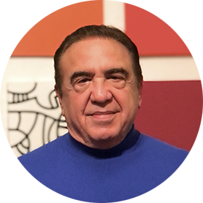
Faculty
Catherine C Coombs, MD
Associate Clinical Professor
Division of Hematology/Oncology
Department of Medicine
UCI Health
Orange County, California
MODERATOR
Neil Love, MD Research To Practice Miami, Florida
William G Wierda, MD, PhD
Jane and John Justin Distinguished Chair in Leukemia Research in Honor of Dr Elihu Estey
Section Chief, Chronic Lymphocytic Leukemia
Center Medical Director
Department of Leukemia, Division of Cancer Medicine
Executive Medical Director, Inpatient Medical Services
The University of Texas MD Anderson Cancer Center
Houston, Texas

Slide 3
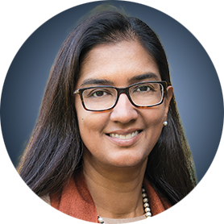
Contributing Faculty
John N Allan, MD
Associate Professor of Clinical Medicine
Weill Cornell Medicine
New York, New York
Jeff Sharman, MD
Medical Director of Hematology Research
Sarah Cannon Research Institute at
Willamette Valley Cancer Center
Eugene, Oregon
Matthew S Davids, MD, MMSc
Associate Professor of Medicine
Harvard Medical School
Leader, Lymphoma Program
Dana-Farber/Harvard Cancer Center
Director of Clinical Research
Division of Lymphoma
Dana-Farber Cancer Institute
Boston, Massachusetts
Tanya Siddiqi, MD
Medical Director of Lymphoma
City of Hope Orange County
Professor
Department of Hematology and Hematopoietic Cell Transplantation
Director, Chronic Lymphocytic Leukemia Program
City of Hope
Duarte, California

Slide 4
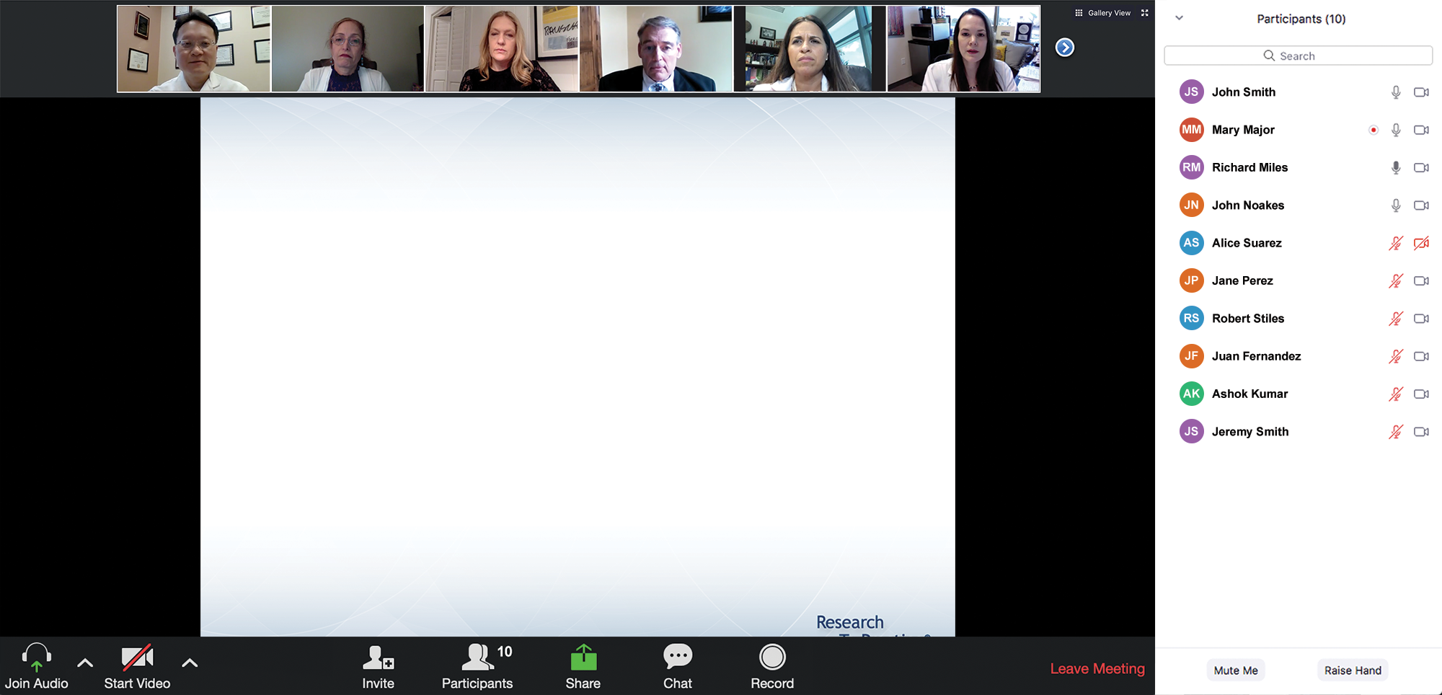
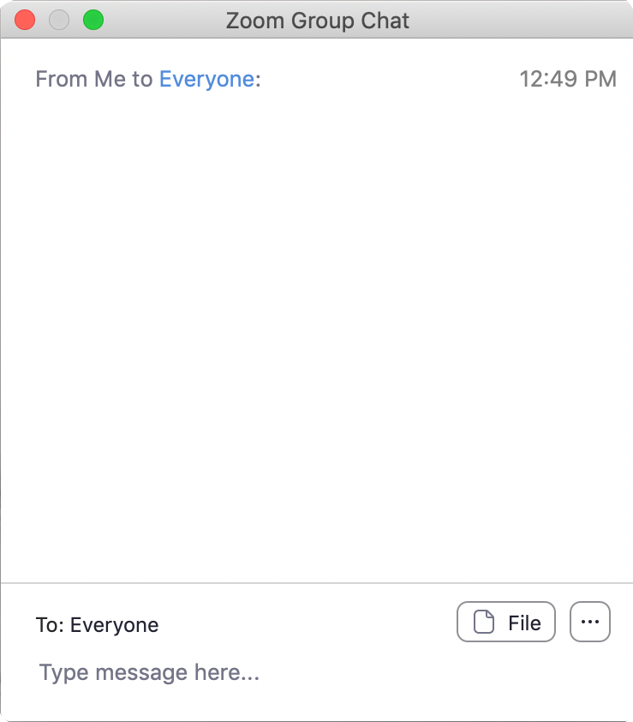
We Encourage Clinicians in Practice to Submit Questions
Feel free to submit questions now before the program begins and throughout the program.

Slide 5
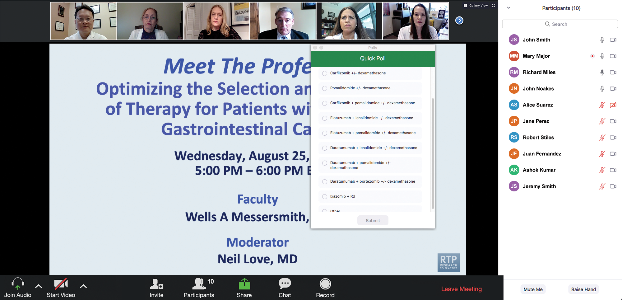
Clinicians in the Audience, Please Complete the Pre- and Postmeeting Surveys
Quick Survey
Quick Poll

Slide 6
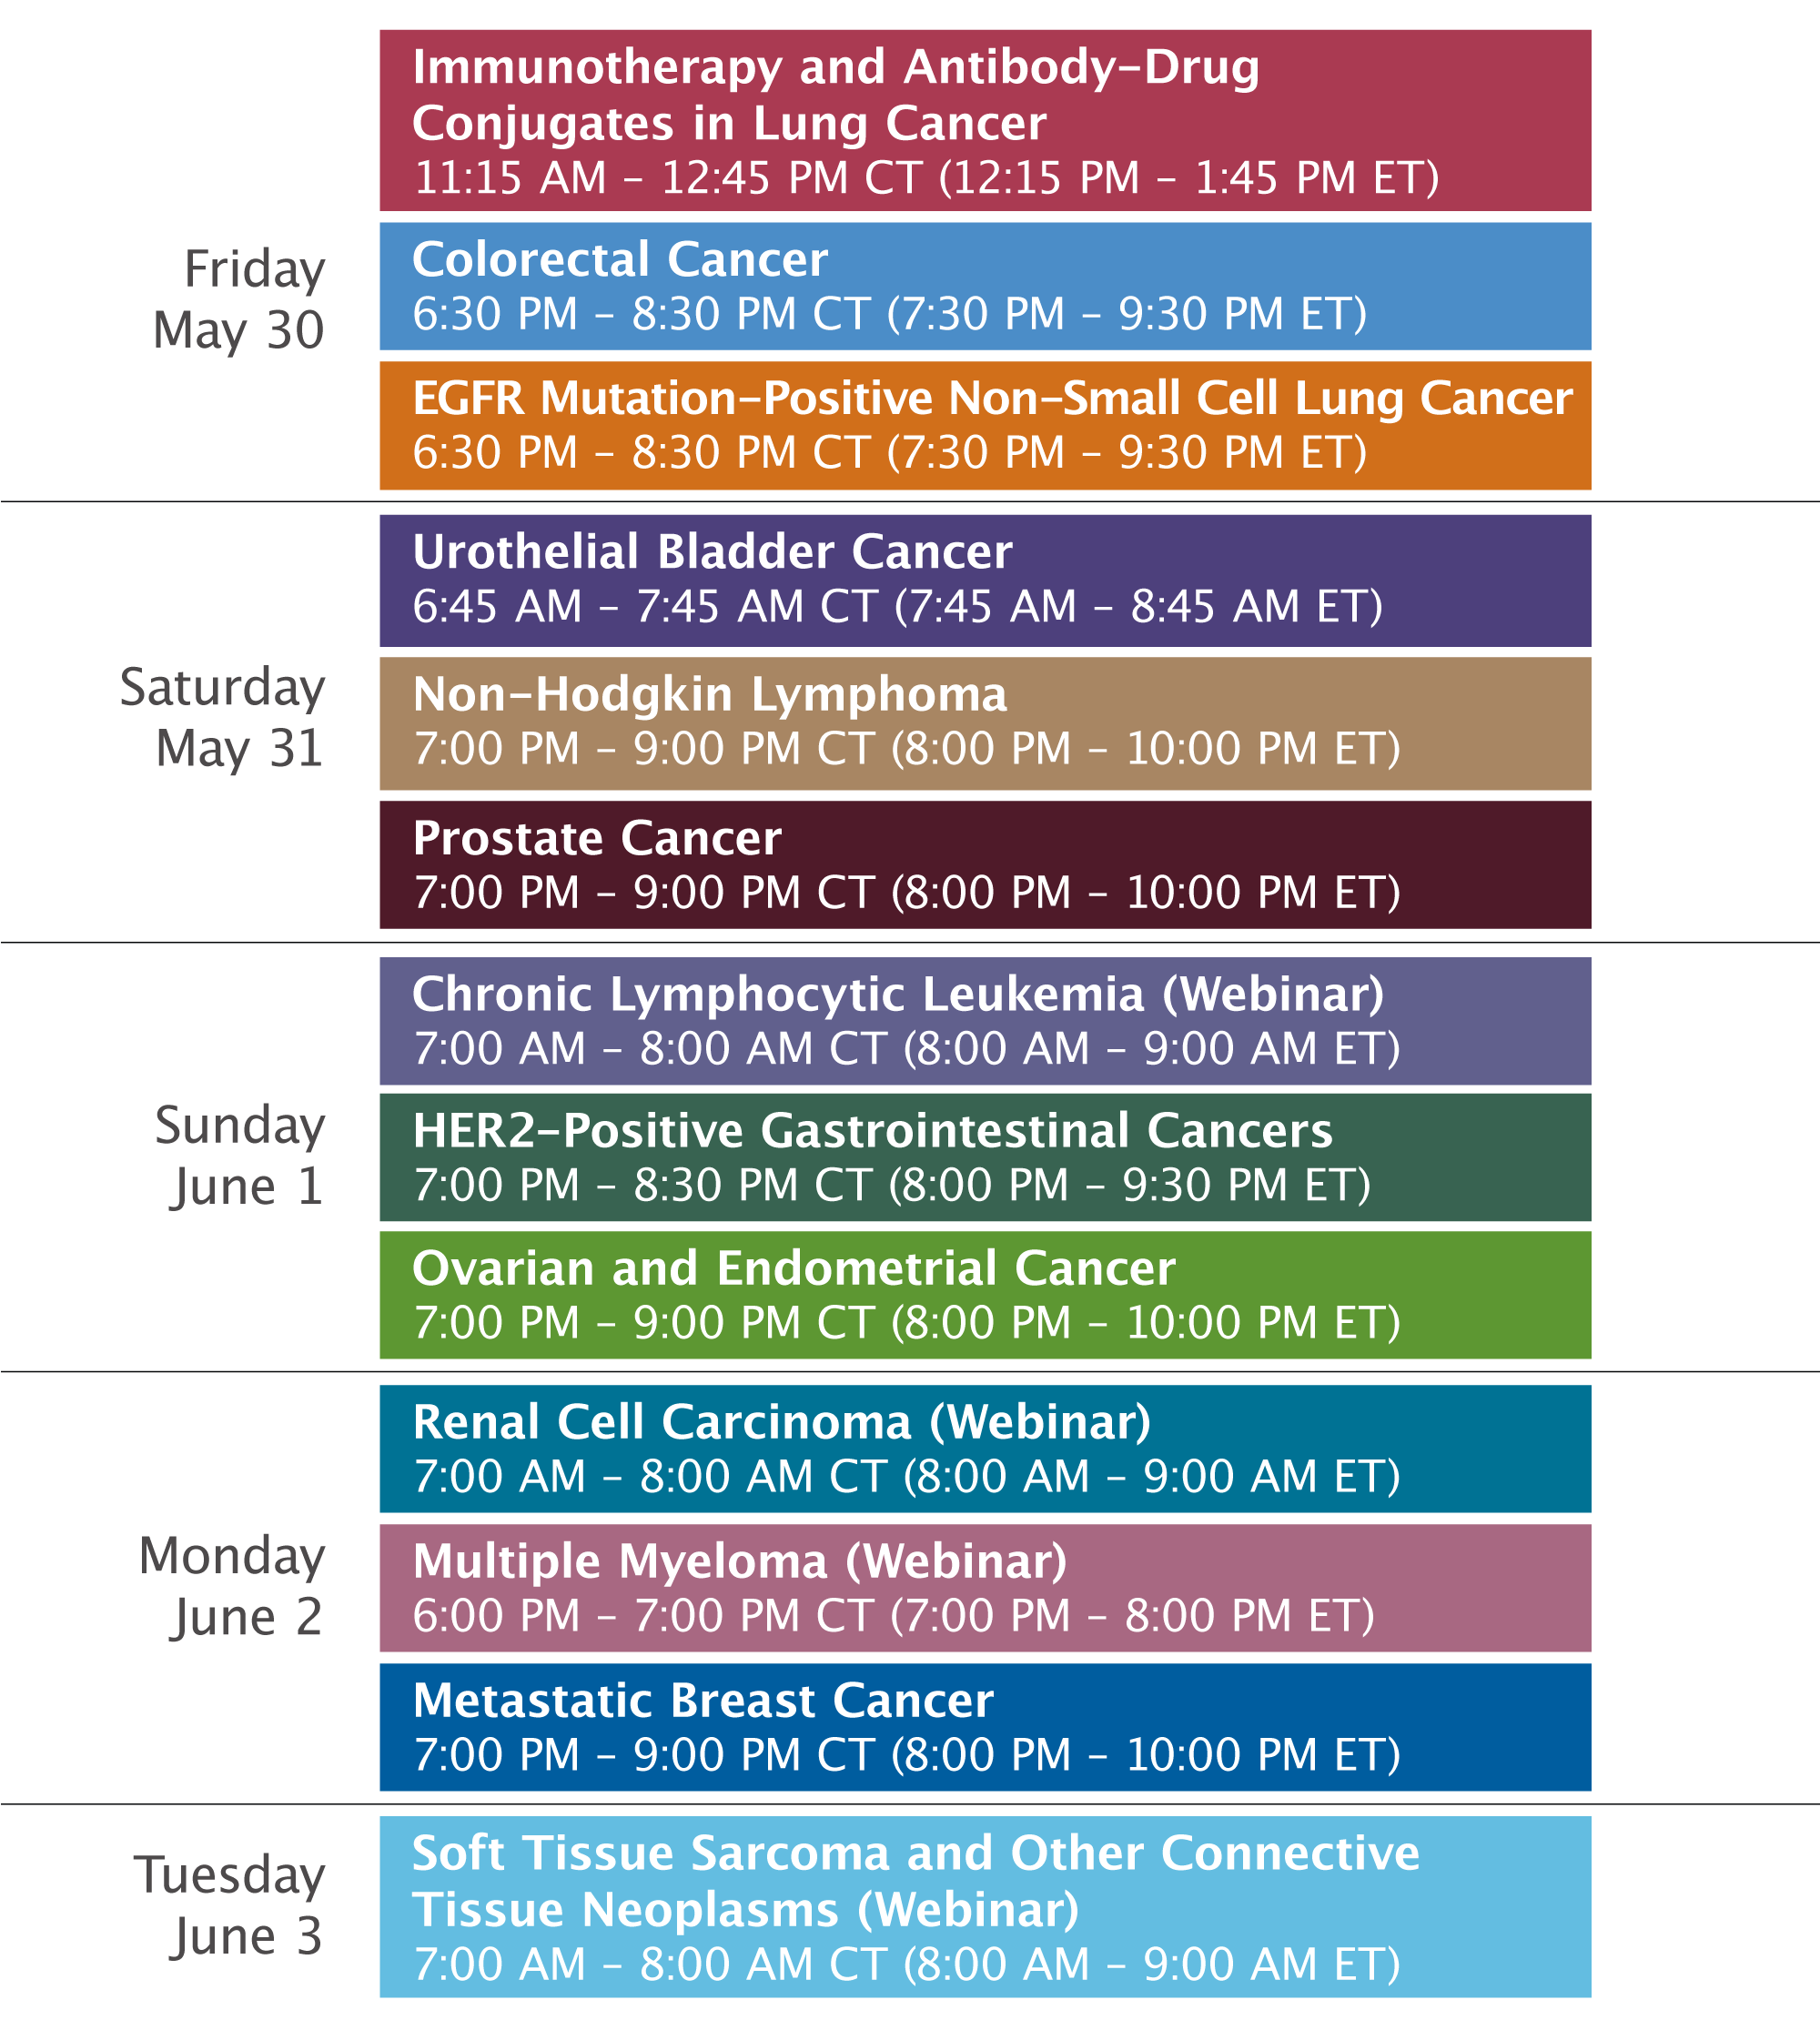

Slide 7
Consensus or Controversy? Clinical Investigators Provide Perspectives on the Current and Future Care of Patients with Chronic Lymphocytic Leukemia
Sunday​, June 1, 2025 7:00 AM – 8:00 AM CT (8:00 AM – 9:00 AM ET)
Faculty
Catherine C Coombs, MD
William G Wierda, MD, PhD
Moderator
Neil Love, MD

Slide 8
Dr Coombs — Disclosures Faculty
Advisory Committees | AbbVie Inc, Allogene Therapeutics, AstraZeneca Pharmaceuticals LP, BeiGene Ltd, Bristol Myers Squibb, Genentech, a member of the Roche Group, Janssen Biotech Inc, Lilly, MingSight Pharmaceuticals, Pharmacyclics LLC, an AbbVie Company
Consulting Agreements | AbbVie Inc, AstraZeneca Pharmaceuticals LP, BeiGene Ltd, Lilly, Octapharma
Contracted Research | AbbVie Inc, BeiGene Ltd, Carna Biosciences, Lilly
Speakers Bureaus | AbbVie Inc, AstraZeneca Pharmaceuticals LP, BeiGene Ltd, Genentech, a member of the Roche Group, Lilly
Stock Options/Stock — Public Companies | Geron Corporation, Pfizer Inc

Slide 9
Dr Wierda — Disclosures Faculty
Consulting Agreements | BeiGene Ltd, Numab Therapeutics AG
Contracted Research | AbbVie Inc, Acerta Pharma — A member of the AstraZeneca Group, Bristol Myers Squibb, Cyclacel Pharmaceuticals Inc, Genentech, a member of the Roche Group, Gilead Sciences Inc, GSK, Janssen Biotech Inc, Juno Therapeutics, a Celgene Company, Kite, A Gilead Company, Loxo Oncology Inc, a wholly owned subsidiary of Eli Lilly & Company, Novartis, Nurix Therapeutics Inc, Oncternal Therapeutics, Pharmacyclics LLC, an AbbVie Company
Nonrelevant Financial Relationships | National Comprehensive Cancer Network (Chair, CLL), Support by the NIH/NCI under award number P30 CA016672 and use of MD Anderson Cancer Center Support Grant (CCSG) shared resources

Slide 10
Dr Allan — Disclosures Survey Participant
Advisory Committees | NeoGenomics
Consulting Agreements | AbbVie Inc, Adaptive Biotechnologies Corporation, ADC Therapeutics, AstraZeneca Pharmaceuticals LP, BeiGene Ltd, Genentech, a member of the Roche Group,Janssen Biotech Inc, Lilly, Pharmacyclics LLC, an AbbVie Company
Contracted Research | BeiGene Ltd, Bristol Myers Squibb, Genentech, a member of the Roche Group
Data and Safety Monitoring Boards/Committees | Merck
Speakers Bureaus | AbbVie Inc, BeiGene Ltd

Slide 11
Dr Davids — Disclosures Survey Participant
Consulting Agreements | AbbVie Inc, Adaptive Biotechnologies Corporation, Ascentage Pharma, AstraZeneca Pharmaceuticals LP, BeiGene Ltd, Bristol Myers Squibb, Galapagos NV, Genentech, a member of the Roche Group, Genmab US Inc, Janssen Biotech Inc, Lilly, MEI Pharma Inc, Merck, Nuvalent, Schrödinger, Secura Bio, Takeda Pharmaceuticals USA Inc, TG Therapeutics Inc
Contracted Research | Ascentage Pharma, MEI Pharma Inc, Novartis
Nonrelevant Financial Relationships | UpToDate

Slide 12
Dr Sharman — Disclosures Survey Participant
Consulting Agreements and Contracted Research | AbbVie Inc, AstraZeneca Pharmaceuticals LP, BeiGene Ltd, Bristol Myers Squibb, Genentech, a member of the Roche Group, Lilly, Merck

Slide 13
Dr Siddiqi — Disclosures Survey Participant
Advisory Committees | AbbVie Inc, AstraZeneca Pharmaceuticals LP, BeiGene Ltd, Bristol Myers Squibb, Celgene Corporation, Gilead Sciences Inc
Contracted Research | Bristol Myers Squibb
Data and Safety Monitoring Boards/Committees | BeiGene Ltd
Speakers Bureaus | AstraZeneca Pharmaceuticals LP

Slide 14
Dr Love — Disclosures
Dr Love is president and CEO of Research To Practice. Research To Practice receives funds in the form of educational grants to develop CME activities from the following companies: Aadi Bioscience, AbbVie Inc, ADC Therapeutics, Alexion Pharmaceuticals, Amgen Inc, Array BioPharma Inc, a subsidiary of Pfizer Inc, Arvinas, Astellas, AstraZeneca Pharmaceuticals LP, Aveo Pharmaceuticals, Bayer HealthCare Pharmaceuticals, BeiGene Ltd, Black Diamond Therapeutics Inc, Blueprint Medicines, Boehringer Ingelheim Pharmaceuticals Inc, Bristol Myers Squibb, Clovis Oncology, Coherus BioSciences, CTI BioPharma, a Sobi Company, Daiichi Sankyo Inc, Eisai Inc, Elevation Oncology Inc, Exact Sciences Corporation, Exelixis Inc, Genentech, a member of the Roche Group, Genmab US Inc, Geron Corporation, Gilead Sciences Inc, GSK, Hologic Inc, ImmunoGen Inc, Incyte Corporation, Ipsen Biopharmaceuticals Inc, Jazz Pharmaceuticals Inc, Johnson & Johnson, Karyopharm Therapeutics, Kite, A Gilead Company, Kura Oncology, Legend Biotech, Lilly, MEI Pharma Inc, Merck, Mersana Therapeutics Inc, Mirati Therapeutics Inc, Mural Oncology Inc, Natera Inc, Novartis, Novartis Pharmaceuticals Corporation on behalf of Advanced Accelerator Applications, Novocure Inc, Nuvalent, Pfizer Inc, Pharmacyclics LLC, an AbbVie Company, Puma Biotechnology Inc, Regeneron Pharmaceuticals Inc, Rigel Pharmaceuticals Inc, R-Pharm US, Sanofi, Seagen Inc, Servier Pharmaceuticals LLC, SpringWorks Therapeutics Inc, Stemline Therapeutics Inc, Syndax Pharmaceuticals, Taiho Oncology Inc, Takeda Pharmaceuticals USA Inc, TerSera Therapeutics LLC, and Tesaro, A GSK Company.

Slide 15
Commercial Support
This activity is supported by an educational grant from Lilly.
Research To Practice CME Planning Committee Members, Staff and Reviewers
Planners, scientific staff and independent reviewers for Research To Practice have no relevant conflicts of interest to disclose.

Slide 16
This educational activity contains discussion of non-FDA-approved uses of agents and regimens. Please refer to official prescribing information for each product for approved indications.

Slide 17
Agenda
Module 1: Selection and Sequencing of Therapy for Relapsed/Refractory (RR) Chronic Lymphocytic Leukemia (CLL) — Dr Wierda
Module 2: First-Line Therapy for CLL — Dr Coombs
Module 3: Novel Agents and Strategies for RR CLL — Dr Wierda
Module 4: ASCO and EHA 2025

Slide 18
Agenda
Module 1: Selection and Sequencing of Therapy for Relapsed/Refractory (RR) Chronic Lymphocytic Leukemia (CLL) — Dr Wierda
Module 2: First-Line Therapy for CLL — Dr Coombs
Module 3: Novel Agents and Strategies for RR CLL — Dr Wierda
Module 4: ASCO and EHA 2025

Slide 19
Regulatory and reimbursement issues aside, what would be your preferred third-line systemic therapy for a 60-year-old patient with double-refractory CLL? Regulatory and reimbursement issues aside, what would be your preferred third-line systemic therapy for an 80-year-old patient with double-refractory CLL?
Beyond Covalent BTK Inhibitors and Venetoclax

Slide 20
Regulatory and reimbursement issues aside, what second-line systemic therapy would you recommend for a 60-year-old patient who has experienced disease progression on a covalent BTK inhibitor and is not a candidate for venetoclax because of comorbidities? Regulatory and reimbursement issues aside, what second-line systemic therapy would you recommend for an 80-year-old patient who has experienced disease progression on a covalent BTK inhibitor and is not a candidate for venetoclax because of comorbidities?
Beyond Covalent BTK Inhibitors and Venetoclax

Slide 21
Regulatory and reimbursement issues aside, what systemic therapy would you recommend next for a 60-year-old patient who has experienced disease progression on venetoclax/obinutuzumab and developed unacceptable tolerability issues (bleeding, arthralgias) on a covalent BTK inhibitor? Regulatory and reimbursement issues aside, what systemic therapy would you recommend next for an 80-year-old patient who has experienced disease progression on venetoclax/obinutuzumab and developed unacceptable tolerability issues (bleeding, arthralgias) on a covalent BTK inhibitor?
Beyond Covalent BTK Inhibitors and Venetoclax

Slide 22
In which line of therapy are you currently using pirtobrutinib for your patients with CLL?
Third line
Second line and beyond
Third line
Third line
Third line
Fourth line

Slide 23
Based on current clinical trial data and your personal experience, how would you compare the global efficacy and tolerability/toxicity of pirtobrutinib to those of ibrutinib, acalabrutinib and zanubrutinib for patients with relapsed/refractory CLL?
Efficacy
Tolerability/toxicity
There are not enough available data at this time
Pirtobrutinib has the least toxicity
There are not enough available data at this time
Pirtobrutinib has the least toxicity
About the same
Pirtobrutinib has the least toxicity
There are not enough available data at this time
Pirtobrutinib has the least toxicity
There are not enough available data at this time
Pirtobrutinib has the least toxicity
About the same
Pirtobrutinib has the least toxicity

Slide 24
Based on the published literature and/or your clinical experience, please estimate the percent chance that a patient with CLL who is receiving ibrutinib will experience toxicity during treatment that will require withholding or permanently discontinuing administration. What is the primary toxicity patients experience that leads to withholding this drug/regimen?
Chance of withholding
Chance of discontinuation
Primary toxicity
50%
40%
Cardiac; myalgias/arthralgias
40%
40%
Various
20%
20%
BTKi class effects
40%
20%
Atrial fibrillation
50%
40%
Arthralgias
20%
20%
Arthralgias
BTKi = BTK inhibitor

Slide 25
Based on the published literature and/or your clinical experience, please estimate the percent chance that a patient with CLL who is receiving acalabrutinib will experience toxicity during treatment that will require withholding or permanently discontinuing administration. What is the primary toxicity patients experience that leads to withholding this drug/regimen?
Chance of withholding
Chance of discontinuation
Primary toxicity
15%
10%
Headache
20%
10%
Various
15%
15%
BTKi class effects
20%
10%
Headache
20%
10%
Various
15%
10%
Fatigue

Slide 26
Based on the published literature and/or your clinical experience, please estimate the percent chance that a patient with CLL who is receiving zanubrutinib will experience toxicity during treatment that will require withholding or permanently discontinuing administration. What is the primary toxicity patients experience that leads to withholding this drug/regimen?
Chance of withholding
Chance of discontinuation
Primary toxicity
15%
10%
I’ve not recognized a predominant toxicity yet
20%
10%
Various
15%
15%
BTKi class effects
20%
10%
Hypertension
25%
10%
Various
10%
5%
Fatigue

Slide 27
Based on the published literature and/or your clinical experience, please estimate the percent chance that a patient with CLL who is receiving pirtobrutinib will experience toxicity during treatment that will require withholding or permanently discontinuing administration. What is the primary toxicity patients experience that leads to withholding this drug/regimen?
Chance of withholding
Chance of discontinuation
Primary toxicity
5%
5%
Neutropenia; GI
15%
5%
Various
10%
10%
BTKi class effects
15%
5%
Bleeding
10%
10%
Infection
5%
5%
Bleeding

Slide 28
Are there any differences in the way you think through eligibility in terms of patient age, comorbidities, et cetera for CAR T-cell therapy versus other available treatments? For patients who are eligible to receive pirtobrutinib and CAR T-cell therapy, which one do you generally recommend first?
Select Questions on Chimeric Antigen Receptor (CAR) T-Cell Therapy

Slide 29
In general, do you use bridging therapy for your patients who are being referred for CAR T-cell therapy? If so, what’s your usual treatment approach? Do you believe patients with RR CLL have been “cured” with CAR T-cell therapy?
Select Questions on CAR T-Cell Therapy

Slide 30
Based on the published literature and/or your clinical experience, what is the chance that a patient with CLL receiving CAR T-cell therapy will experience CRS? What about ICANS? What is your approach to monitoring and managing these toxicities?
Select Questions on CAR T-Cell Therapy

Slide 31
At what point in the treatment course are you referring patients with multiregimen-relapsed CLL for consultation regarding CAR T-cell therapy?
Case by case basis; third line for young, fit patients
Depends more on the patient’s clinical situation
After third relapse
At second relapse
When pirtobrutinib treatment is initiated
At second relapse

Slide 32
To approximately how many patients with CLL have you administered lisocabtagene maraleucel (liso-cel) within or outside of a protocol setting?
0
25
0
0
4
~30

Slide 33
Selection and Sequencing of Therapy for Relapsed/Refractory CLL June 1, 2025
William G. Wierda MD, PhD
Professor of Medicine
Section Head, CLL
Department of Leukemia
U.T. M.D. Anderson Cancer Center
Houston, TX USA

Slide 34
Targeted Therapy Sequencing for CLL
Factors affecting timelines:
Age
Del(17p) / TP53-m
IGHV-MS / Del(11q)
Complex karyotype
cBTKi |  |  |  |  |  |  | BCL2i+CD20 |  |  | ncBTKi | ncBTKi
cBTKi |  |  |  |  |  |  | ncBTKi |  |  | BCL2i+CD20
BCL2i+CD20 |  |  |  |  |  | BCL2i+CD20 |  |  |  | cBTKi
BCL2i+CD20 |  |  |  |  |  | cBTKi |  |  |  |  | ncBTKi
1 | 2 | 3 | 4 | 5 | 6 | 7 | 8 | 9 | 10 | 11 | 12 | 13 | 14
cBTKi + BCL2i not included here
Years
Double Exposed vs. Double Refractory:
Exposed ≠ Refractory
Refractory=progression on treatment

Slide 35
Selected First-line Phase III Trials in CLL
Trial | N | Treatment Arms
 |  | Control | Investigational
EA9161 | 720 | IBR + OBIN | IBR + OBIN + VEN
A041702 | 454 | IBR + OBIN | IBR + OBIN + VEN
CLL17 | 909 | IBR | VEN + OBIN | VEN + IBR
MAJIC | 750 | VEN + OBIN | ACA + VEN
CLL16 (del(17p) / TP53-m / CK) | 178 | VEN + OBIN | ACA + VEN + OBIN
CELESTIAL-TNCLL | 640 | VEN + OBIN | SONRO + ZANU
BRUIN CLL-313 | 250 | BR | PIRTO
BRUIN CLL-314 | 650# | IBR | PIRTO
CLL18 | 813 | VEN + OBIN | VEN + PIRTO (Fixed) | VEN + PIRTO (uMRD)
BELLWAVE-011 | 1200 | IBR or ACA | NEMTA
BELLWAVE-008 | 300 | FCR/BR | NEMTA
# enrolls both frontline and R/R BTK-naïve CLL

Slide 36
Differentiated Kinase Inhibition Profile
 | TEC Family Kinases |  |  |  |  | Inhibition of Other Kinases
IC₅₀ (nM) | BTK | ITK | Tec# | TXK* | BMX* | Notable Target Kinases
Ibrutinib² | 0.5 | 10.7 | 78 | 2.0³ | 0.8 | >10 more: EGFR family
Acalabrutinib³ | 5.1 | >1000 | 93 | 368 | 46 | Selective
Zanubrutinib⁴ | 0.22 | 30 | 1.9 | n/a | n/a | N/A (not published)
Vecabrutinib¹ | 3 | 14 | 14 | 474 | 224 | Selective -4 non-Tec family kinases: SRC family, NEK11
Nemtabrutinib⁵ | 4.23 | >10000 | 5.8 | 36.4 | 5.23 | >20 more: SRC & TRK families, RAF1, MEK1
Pirtobrutinib⁶ | 3.15 | >5000 | 1234 | 209 | 1155 | Very Selective
Luxeptinib⁷ | 8.4 | 4.3 | >1000 | n/a | 14.5 | 18 w/ IC₅₀ <10 nM: FLT3 (wt, ITD) c-MET, TRK family & Aurora kinases
Irreversible (covalent)
Reversible (non-covalent)
n/a=not available
* Determined with vecabrutinib free base (also relevant for SRC and EGFR)
# Activated (also relevant for LCK)
¹ Neuman et al., ASH 2016
² Honigberg et al., PNAS 2010
³ Byrd et al., NEJM 2016
⁴ Tam et al., ASH 2016
⁵ Eathiraj et al., Pan Pacific Lymphoma Conference 2016
⁶ Brandhuber et al., SOHO 2018
⁷ Zhang et al, EHA 2018

Slide 37
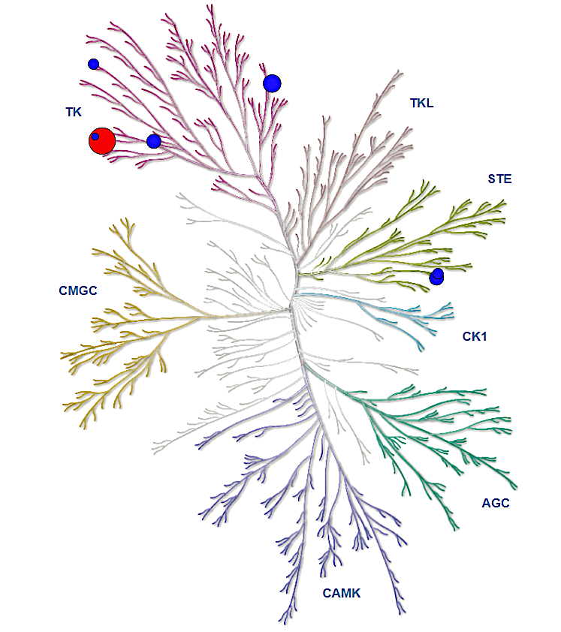
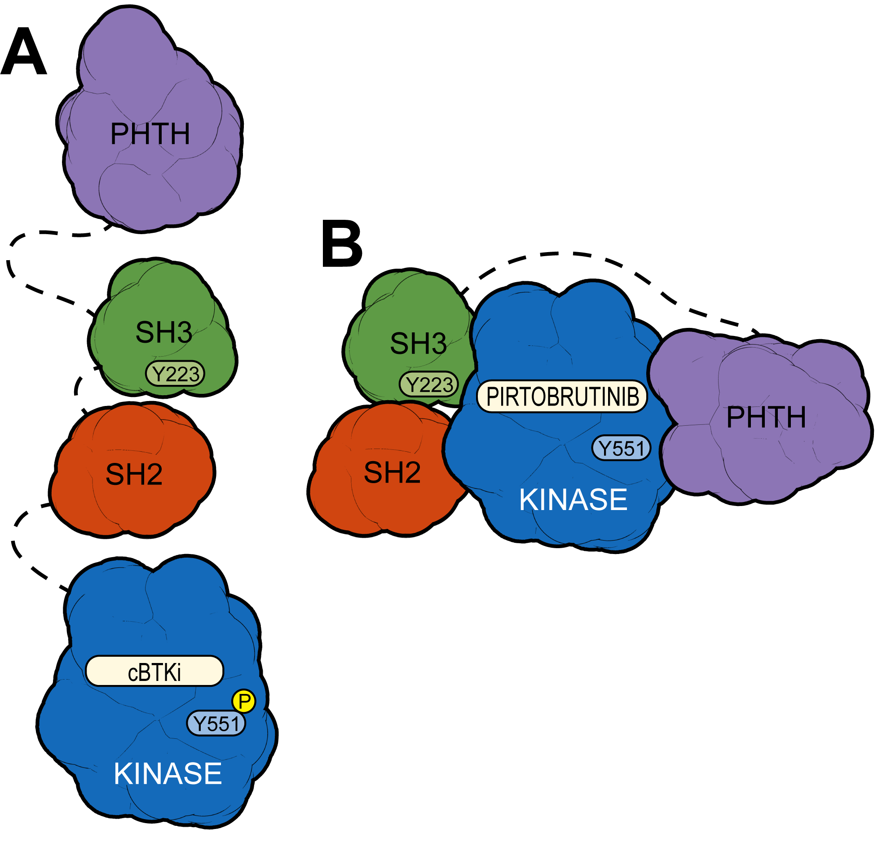
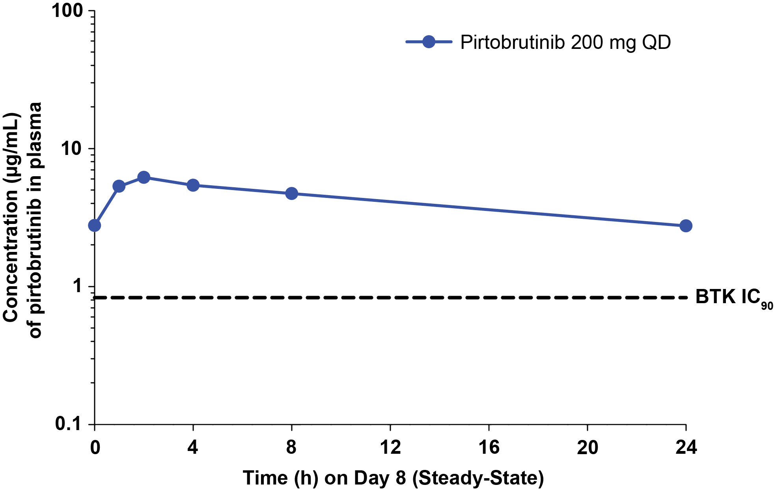
Pirtobrutinib is a Highly Selective, Non-Covalent (Reversible) BTK Inhibitor
Highly selective for BTK⁸⁻⁹
Plasma exposures exceeded BTK IC₉₀
throughout dosing interval
Pirtobrutinib may stabilize/maintain BTK in a closed inactive conformation¹¹
IC₅₀ <10 nM
10 nM < IC₅₀ <50 nM
50 nM < IC₅₀ <100 nM
100 nM < IC₅₀ <200 nM
200 nM < IC₅₀ <500 nM
BTK
Pirtobrutinib is approved in the USA to treat relapsed or refractory MCL after at least two lines of systemic therapy, including prior BTK inhibitor¹⁰
Inhibits both WT and C481-mutant BTK with equal low nM potency in in vitro models¹¹ and CLL cells¹²
Steady state plasma exposure corresponding to 96% BTK target inhibition and a pirtobrutinib-BTK binding complex half-life of about 2 hrs
In contrast to cBTKi (A), pirtobrutinib (B) appears to stabilize BTK in a closed, inactive conformation, blocking access to upstream kinases and phosphorylation of Y551,​ thus inhibiting scaffolding interactions that support kinase-independent BTK signaling¹¹
⁸Mato et al, Lancet 2021. ⁹Brandhuber et al. Clin Lymphoma Myeloma Leuk 2018.¹⁰ Pirtobrutinib [Prescribing Information]. Indianapolis, IN: Eli Lilly and Company, 2023. ¹¹Gomez et al. Blood.2023. ¹² Aslan B et al. Blood Cancer J 2022.

Slide 38
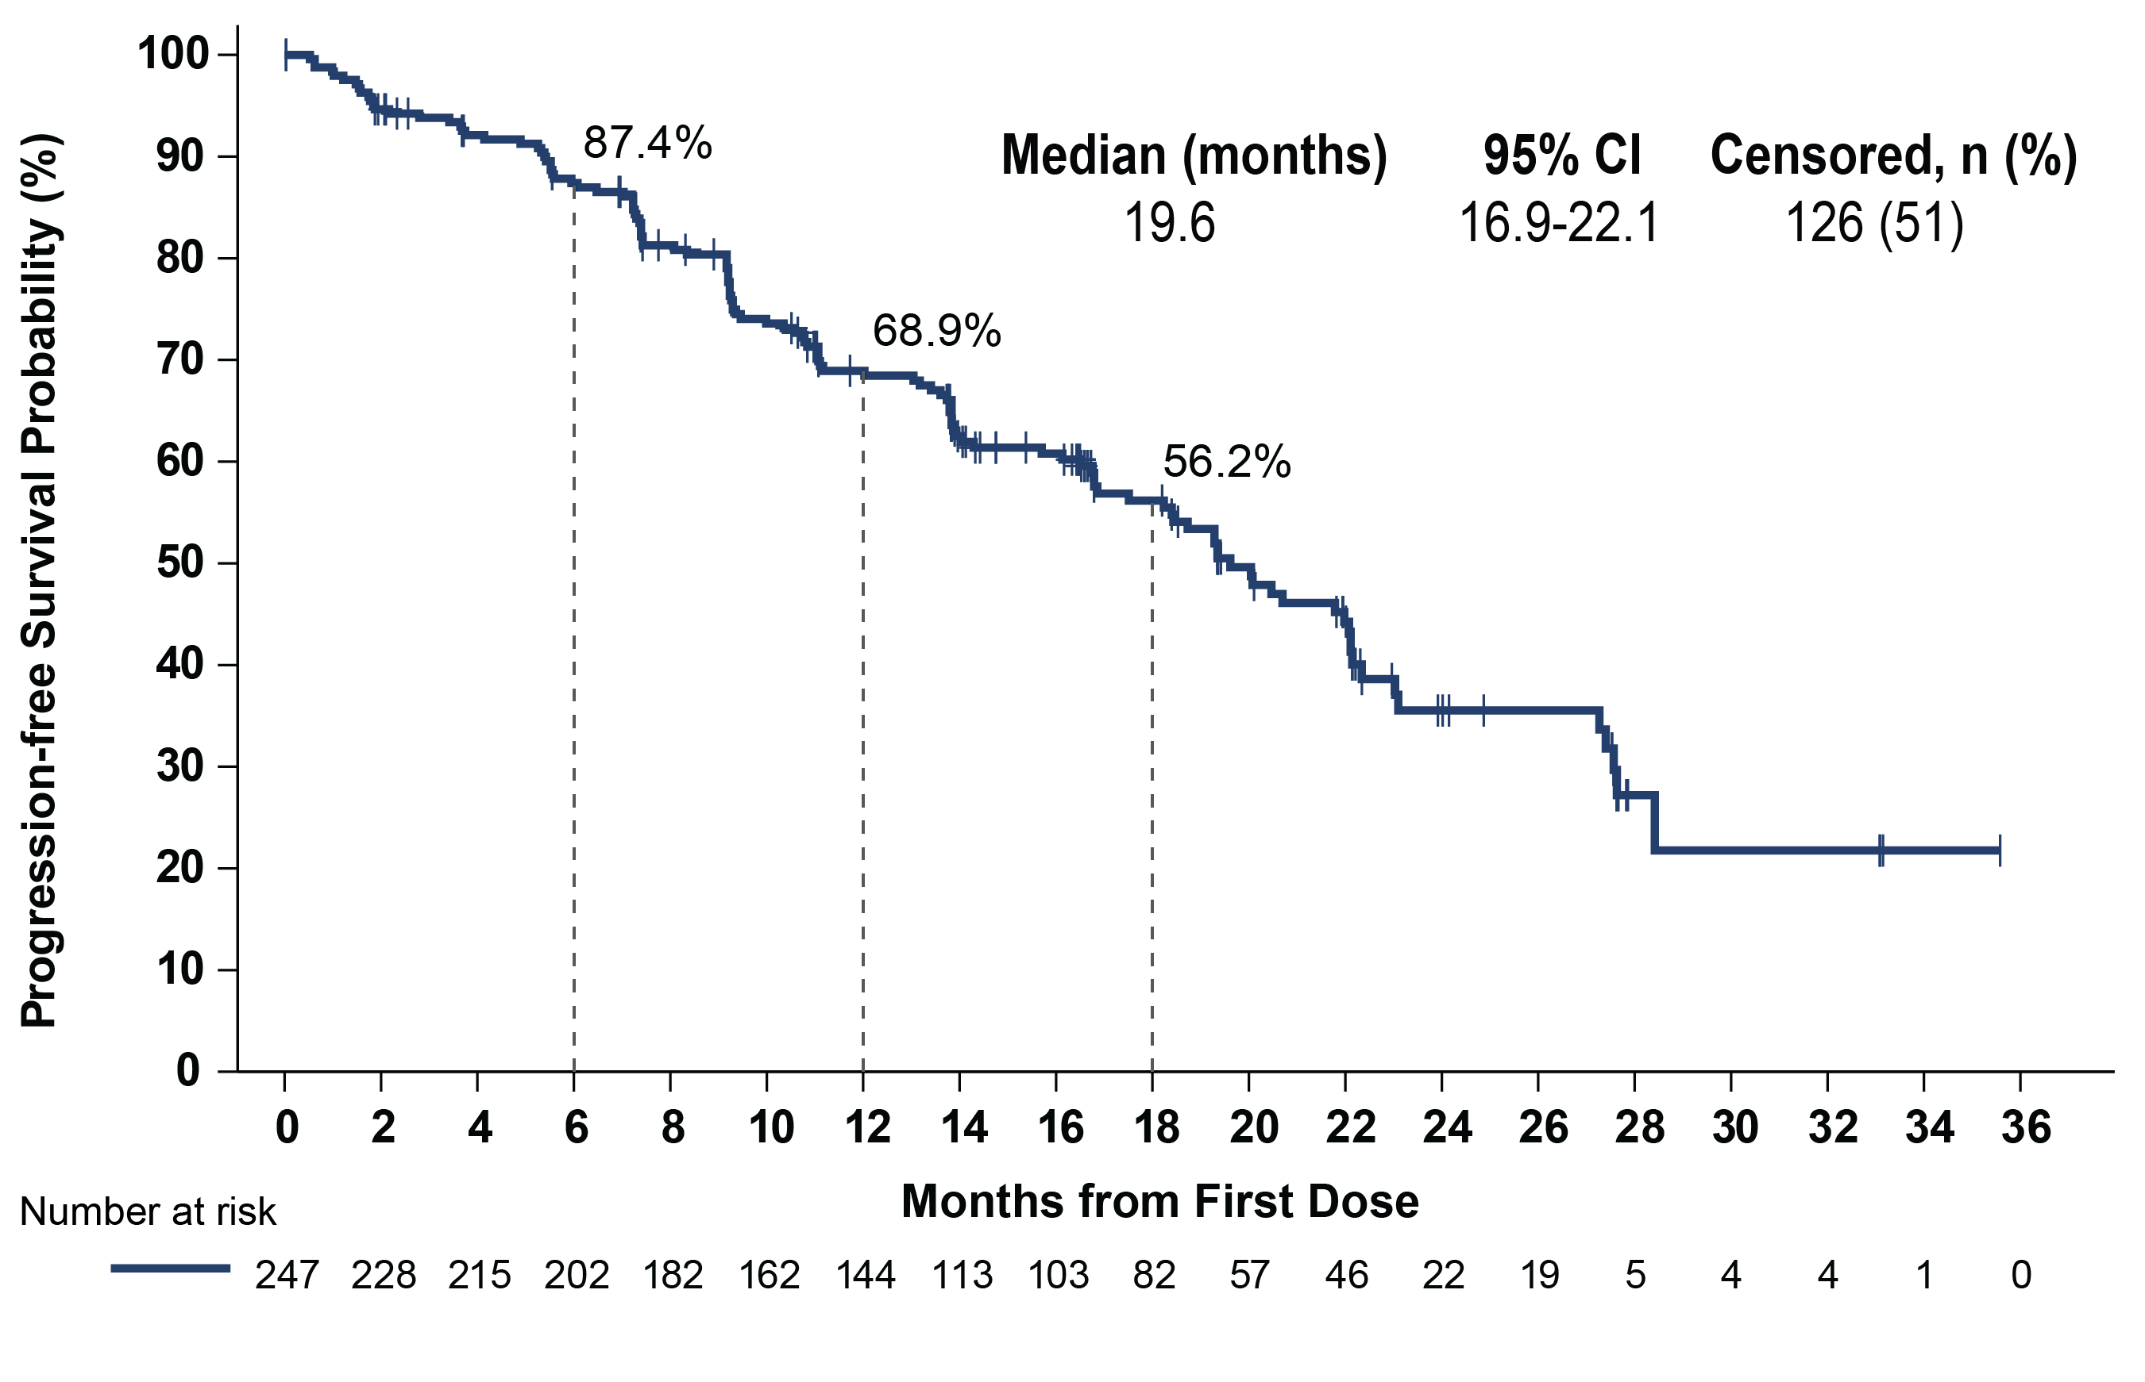
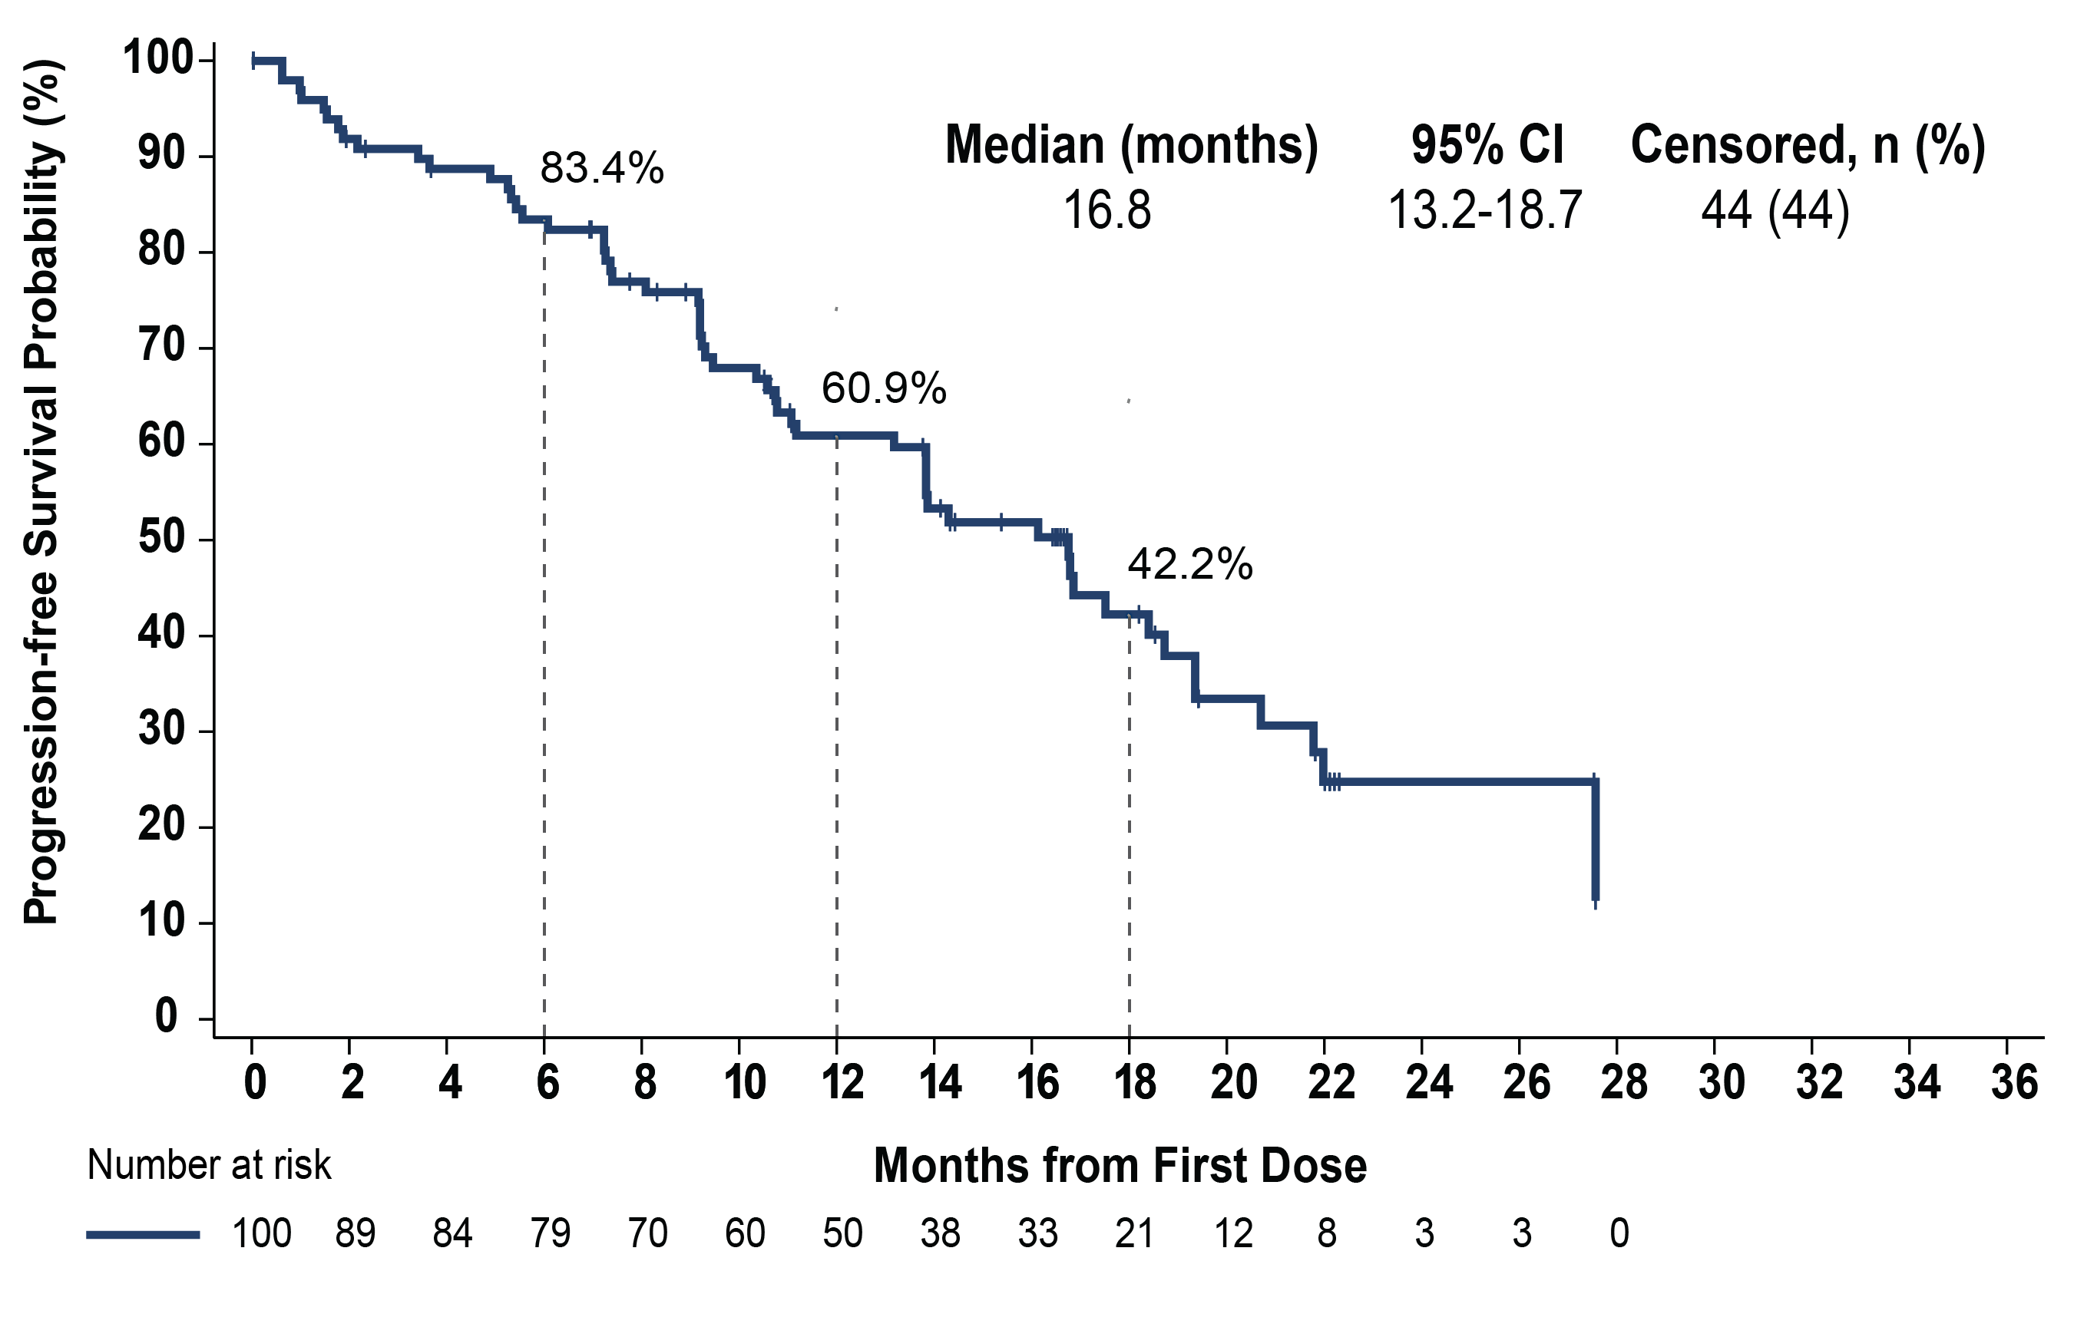
Pirtobrutinib: Progression-Free Survival in CLL/SLL Patients who Received Prior BTKi Treatment
All prior BTKi patients
Median prior lines = 3
Prior BTKi and BCL2i patients
Median prior lines = 5
Median follow-up of 19.4 months for patients who received prior BTKi
Median follow-up of 18.2 months for patients who received prior BTKi and BCL2i
Data cutoff date of 29 July 2022. Response status per iwCLL 2018 according to independent review committee assessment.
Mato et al. ASH 2022, Abstract #961

Slide 39
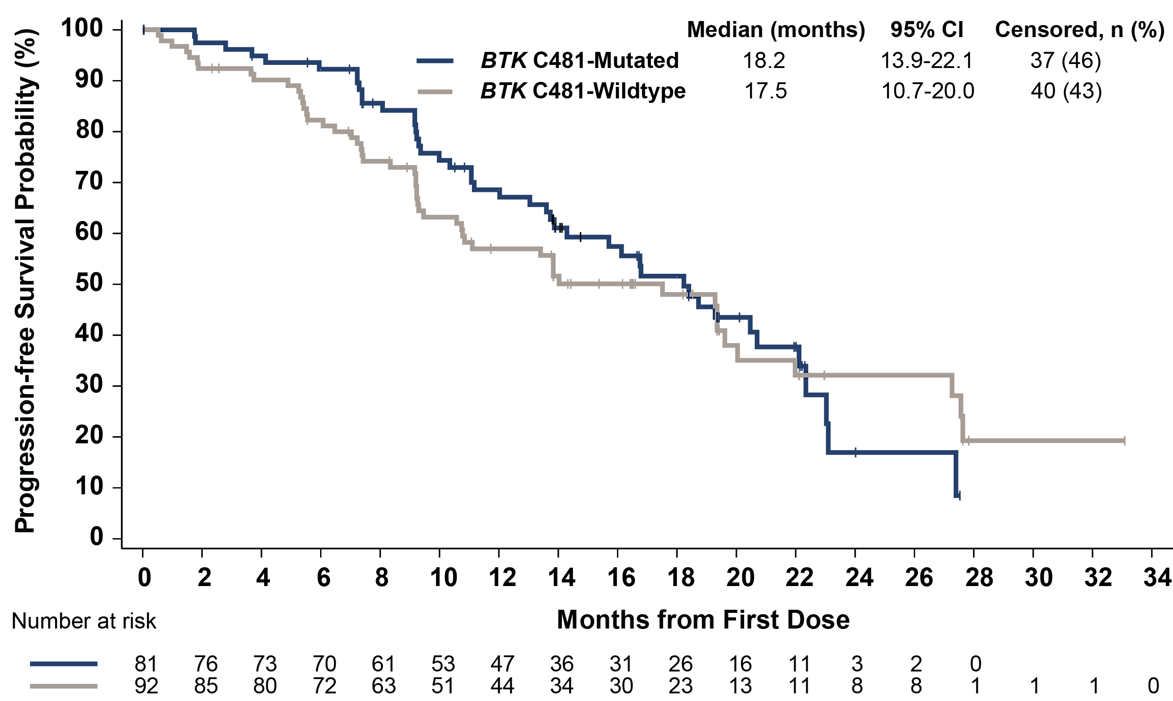
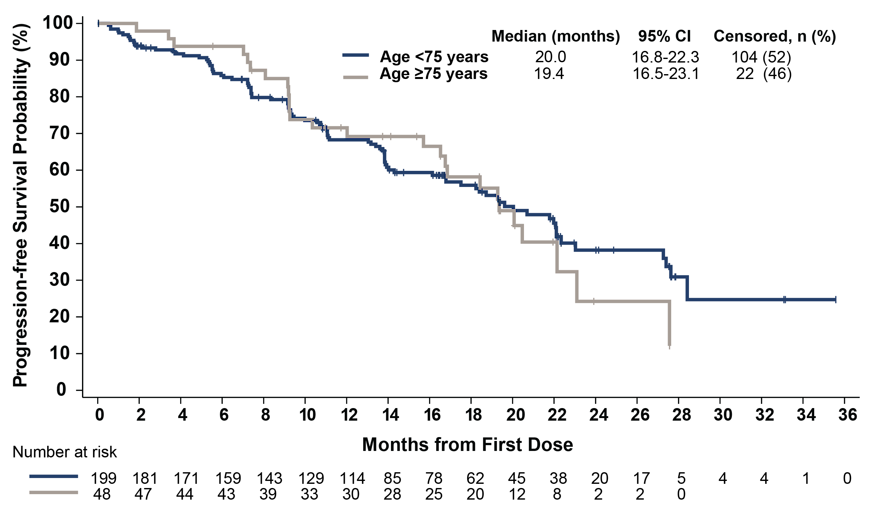
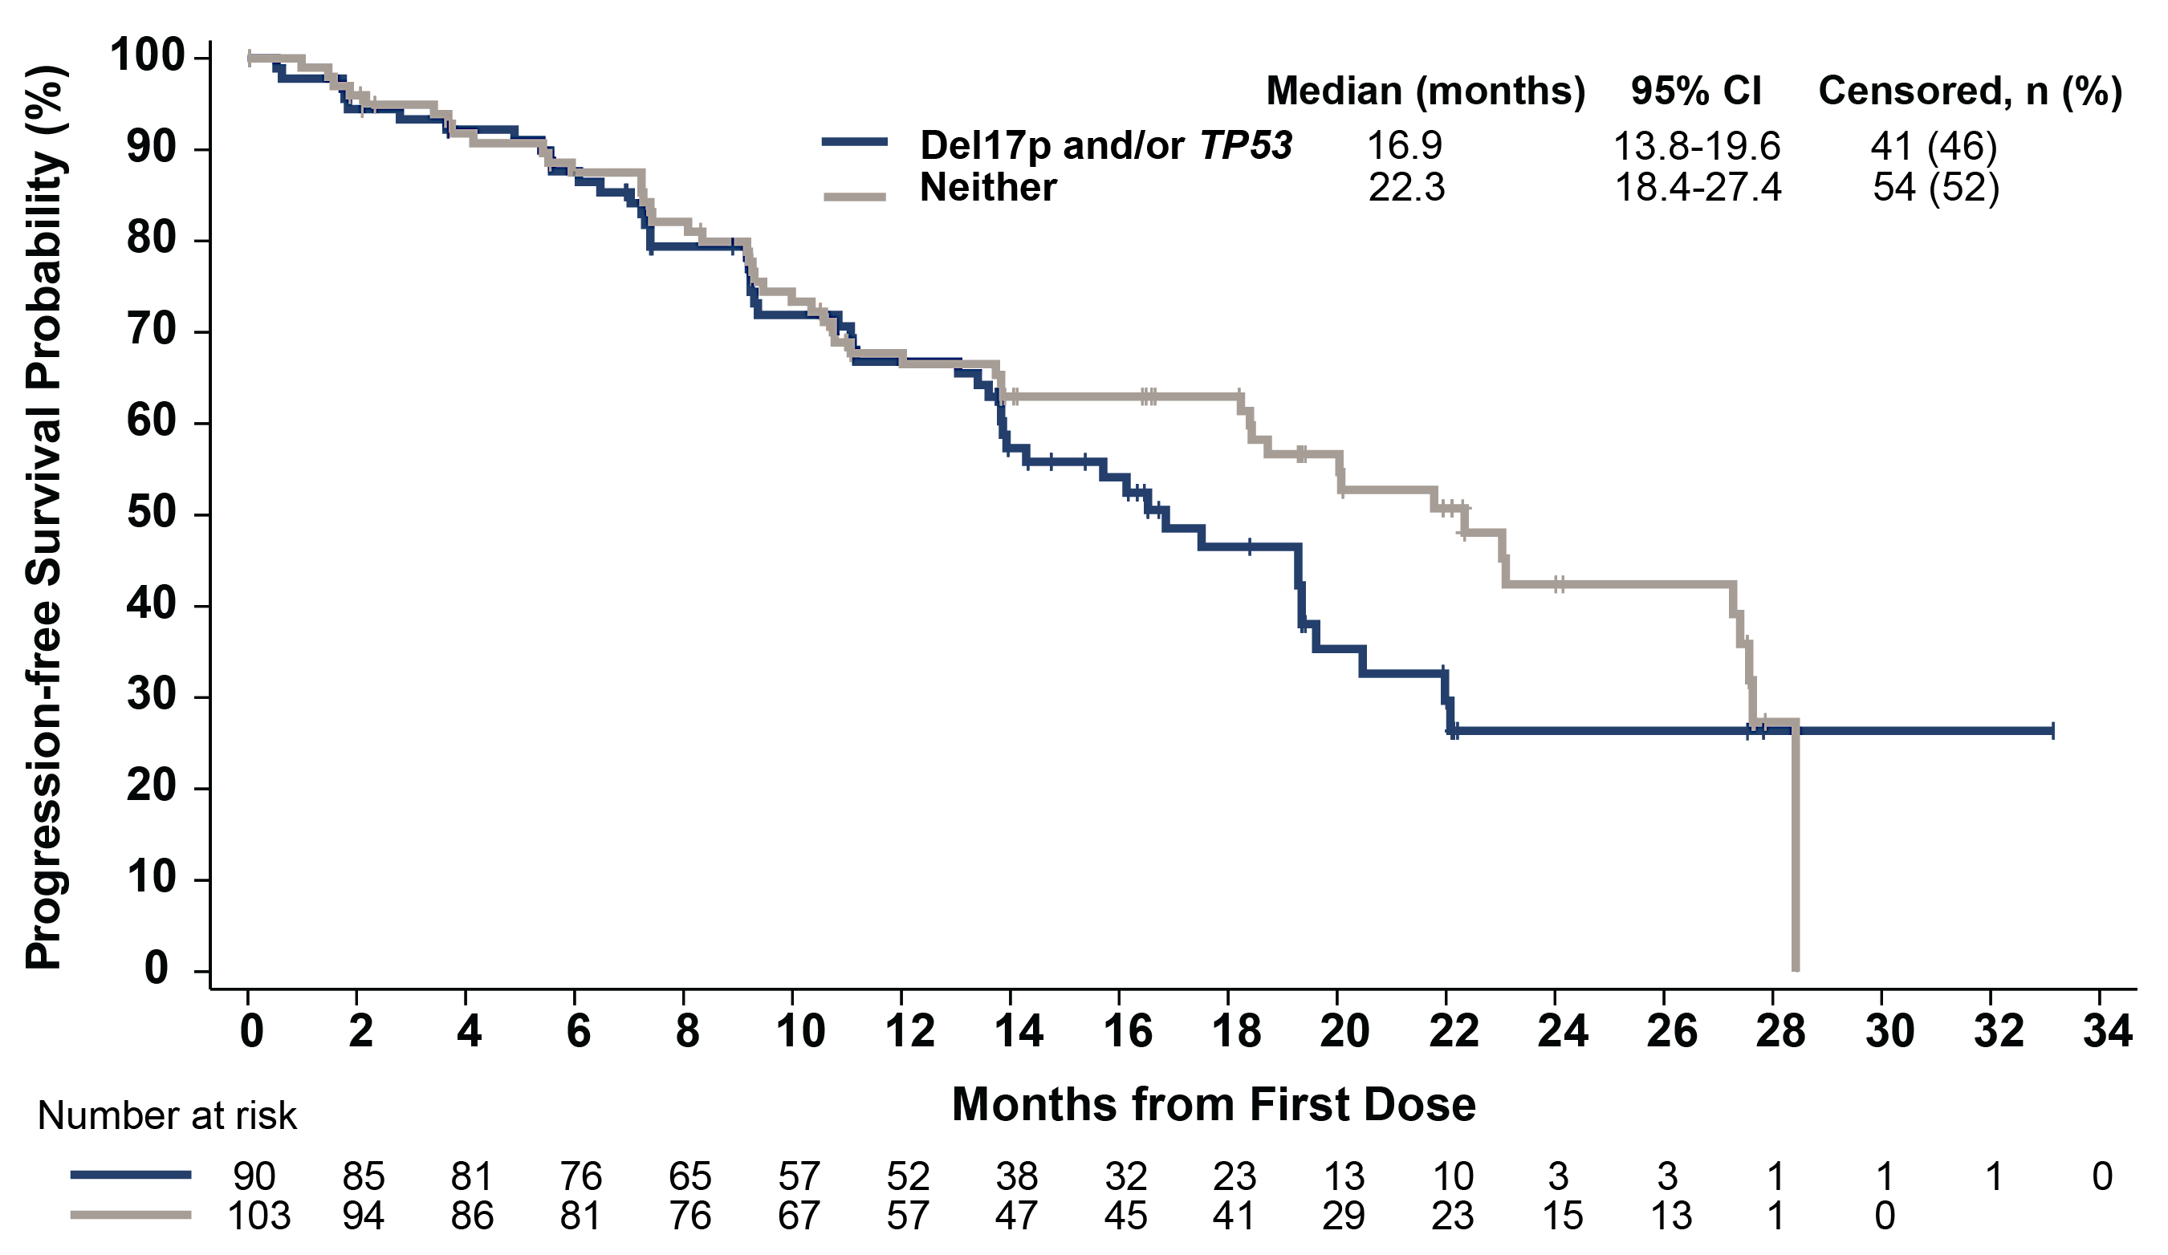
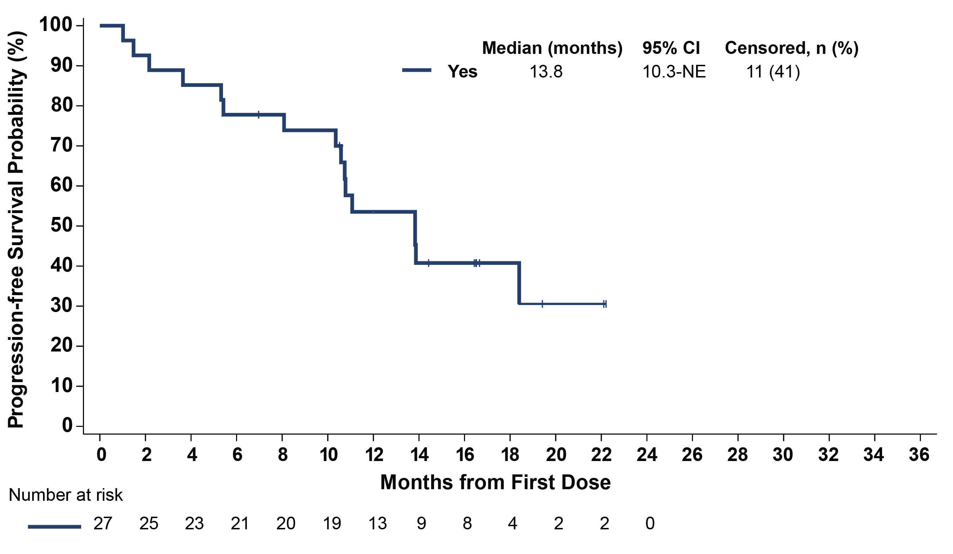
Pirtobrutinib: Progression-Free Survival in CLL/SLL Subgroups
BTK C481 mutation status^{a,b}
Age
del(17p) and/or TP53 mutationª
Prior BTKi, CIT, BCL2i, and PI3Ki therapy
Data cutoff date of 29 July 2022. Response status per iwCLL 2018 according to independent review committee assessment. ªBTK C481 mutation status, del(17p), and TP53 mutation status were centrally determined and based on pre-treatment samples. ^{b}Patients with available mutation data who progressed on any prior BTKi.
Mato et al. ASH 2022, Abstract #961

Slide 40
BRUIN CLL-321: Study Design
Pirtobrutinib Monotherapy
200mg PO QD
Patients with CLL/SLL previously treated with cBTKi
Stratified by:
17p deletion (yes/no)
Prior venetoclax (yes/no)
R
1:1
Optional Crossover (PD confirmed by IRC)^{d}
IdelaR/BR
Idelalisib + Rituximabª
Bendamustine + Rituximab^{b,c}
Key Eligibility
Key Endpoints
Age ≥18
ECOG PS 0-2
Confirmed CLL/SLL requiring treatment per iwCLL 2018
Prior cBTKi required
No limit on prior lines of therapy
Prior history of atrial fibrillation allowed
Primary Endpoint: PFS assessed by IRC
PFS assessed by investigator
Event-Free Survival
Time to Next Treatment
Overall survival
Safety
Treatment was given in 28-day cycles. PFS assessed based on iwCLL2018. ªIdelalisib dosed at 150mg PO BID. Day 1 of cycle 1, first dose of rituximab at 375 mg/m², next 4 infusions at 500 mg/m² every 2 weeks, next 3 infusions at 500 mg/m² every 4 weeks. ^{b}Bendamustine (70 mg/m² ) administered IV D1, D2 of cycles 1-6. ^{c}Day 1 of cycle 1, first dose of rituximab at 375 mg/m², next 5 infusions day 1 of cycle 2 through cycle 6 at 500 mg/m². ^{d}Eligible patients receiving investigator’s choice of IdelaR/BR could crossover to receive pirtobrutinib monotherapy upon confirmation of PD by IRC per protocol. Abbreviations: BID, twice daily; BR, bendamustine + rituximab; cBTKi, covalent Bruton tyrosine kinase inhibitor; CLL, chronic lymphocytic leukemia; ECOG PS, Eastern Cooperative Oncology Group Performance Status; IdelaR, idelalisib + rituximab; IRC, Independent Review Committee; iwCLL, international workshop on chronic lymphocytic leukemia; mg, milligram; PD, progressive disease; PFS, progression-free survival; PO, by mouth; QD, once daily; R, randomized; SLL, small lymphocytic lymphoma.
Sharman, et al., ASH 2024, Abstract #886
Notes:
Eligible patients had relapsed CLL, previously treated with a covalent BTK inhibitor, meeting IWCLL criteria for initiation of therapy. There were no limits on number of prior regimens or history of atrial fibrillation.
Subjects were randomly assigned 1:1 to receive either pirtobrutinib or investigators choice of idelalisib or bendamustine – administered with concurrent rituximab.
Patients were stratified based upon presence or absence of TP53 abnormality and receipt of prior venetoclax.
The primary endpoint of the study was progression free survival by IRC. Key secondary endpoints included investigator assessed PFS, EFS, TNT, OS, and safety outcomes

Slide 41
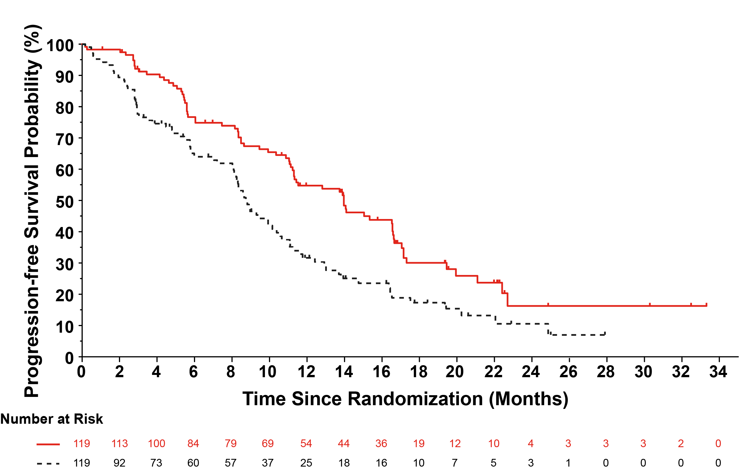
BRUIN CLL-321: IRC-Assessed Progression-free Survival
Pirtobrutinib
n=119
IdelaR/BR
n=119
Number of Events, n (%) | 74 (62) | 79 (66)
Median PFS, mo (95% CI) | 14.0 (11.2-16.6) | 8.7 (8.1-10.4)
Median follow-up, mo | 19.4 | 17.7
Hazard ratio (95% CI) | 0.54 (0.39- 0.75)
Stratified log-rank 2-sided p-value | 0.0002*
Pirtobrutinib
Study met primary endpoint at earlier data cut (Aug 2023)
IRC HR=0.58 (95% CI 0.38- 0.89); p = 0.01
IdelaR/BR
Pirtobrutinib reduced risk of progression or death by 46% according to IRC assessment
*nominal p-value. Abbreviations: BR, bendamustine + rituximab; CI, confidence interval; HR, hazard ratio (pirtobrutinib vs. IdelaR/BR); IdelaR, idelalisib + rituximab; IRC, Independent Review Committee; mo, months; PFS, progression-free survival.
Sharman, et al., ASH 2024, Abstract #886
Notes:
IRC assessed PFS is shown here with a median of 14 months versus 8.7 months for pirtobrutinib vs IC respectively for a hazard ratio of 0.54 and a P value of 0.0002 at this final data cut. Pirtobrutinib reduced the risk of progression or death by 46%.
The shape of the curves, which is step-wise for pirto and continuous for the control arm suggest that many pirtobrutinib events were asymptomatic progressions determined by protocol mandated routine CT scans whereas many control arm PD events were clinically symptomatic and occurred between regularly scheduled scans
As routine asymptomatic scan surveillance is not standard in CLL, these IRC PFS data should be interpreted in the context of additional endpoints such as EFS, and time to next treatment or death

Slide 42
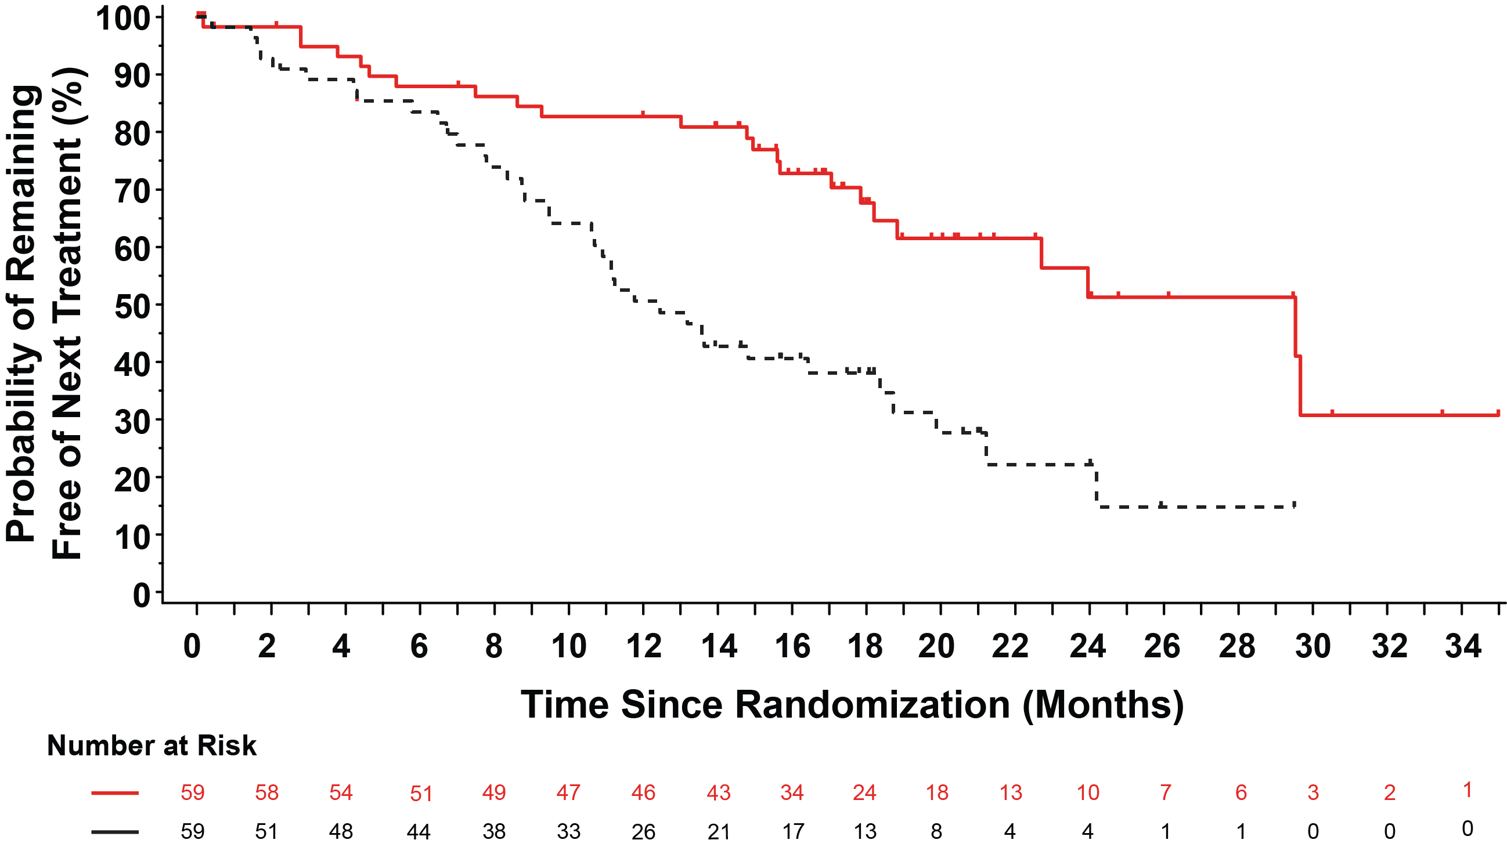
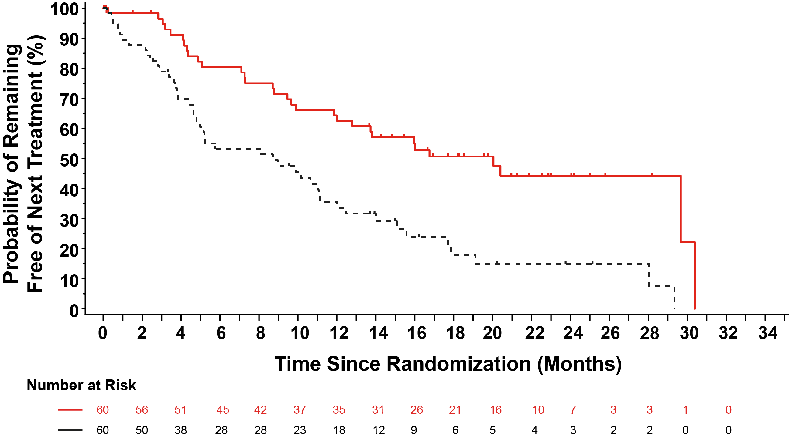
BRUIN CLL-321: Time to Next Treatment or Death in Venetoclax Naïve and Treated Patients​
Venetoclax Naïve
n=59/arm
Venetoclax Treated
n=60/arm
Pirtobrutinib
Pirtobrutinib
IdelaR/BR
IdelaR/BR
Pirtobrutinib
n=119
IdelaR/BR
n=119
Pirtobrutinib
n=119
IdelaR/BR
n=119
Median TTNT, mo (95% CI)​ | 29.5​ | 12.5​
Hazard ratio (95% CI)​ | 0.36 (0.21- 0.61)​
Stratified log-rank 2-sided p-value​ | 0.0001​*
Median TTNT, mo (95% CI)​ | 20.0​ | 8.7​
Hazard ratio (95% CI)​ | 0.37 (0.23- 0.60)​
Stratified log-rank 2-sided p-value​ | <0.0001​​*
*nominal p-value. Abbreviations: BR, bendamustine + rituximab; CI, confidence interval; HR, hazard ratio; IdelaR, idelalisib + rituximab; IRC, independent review committee; mo, months; TTNT, time to next treatment.
Sharman, et al., ASH 2024, Abstract #886
Notes:
We evaluated the TTNTD according to prior venetoclax exposure. The effect size is robust in both subsets, and pirtobrutinib was able to delay subsequent treatment or death for over 2 1/2 years in venetoclax naive patients

Slide 43
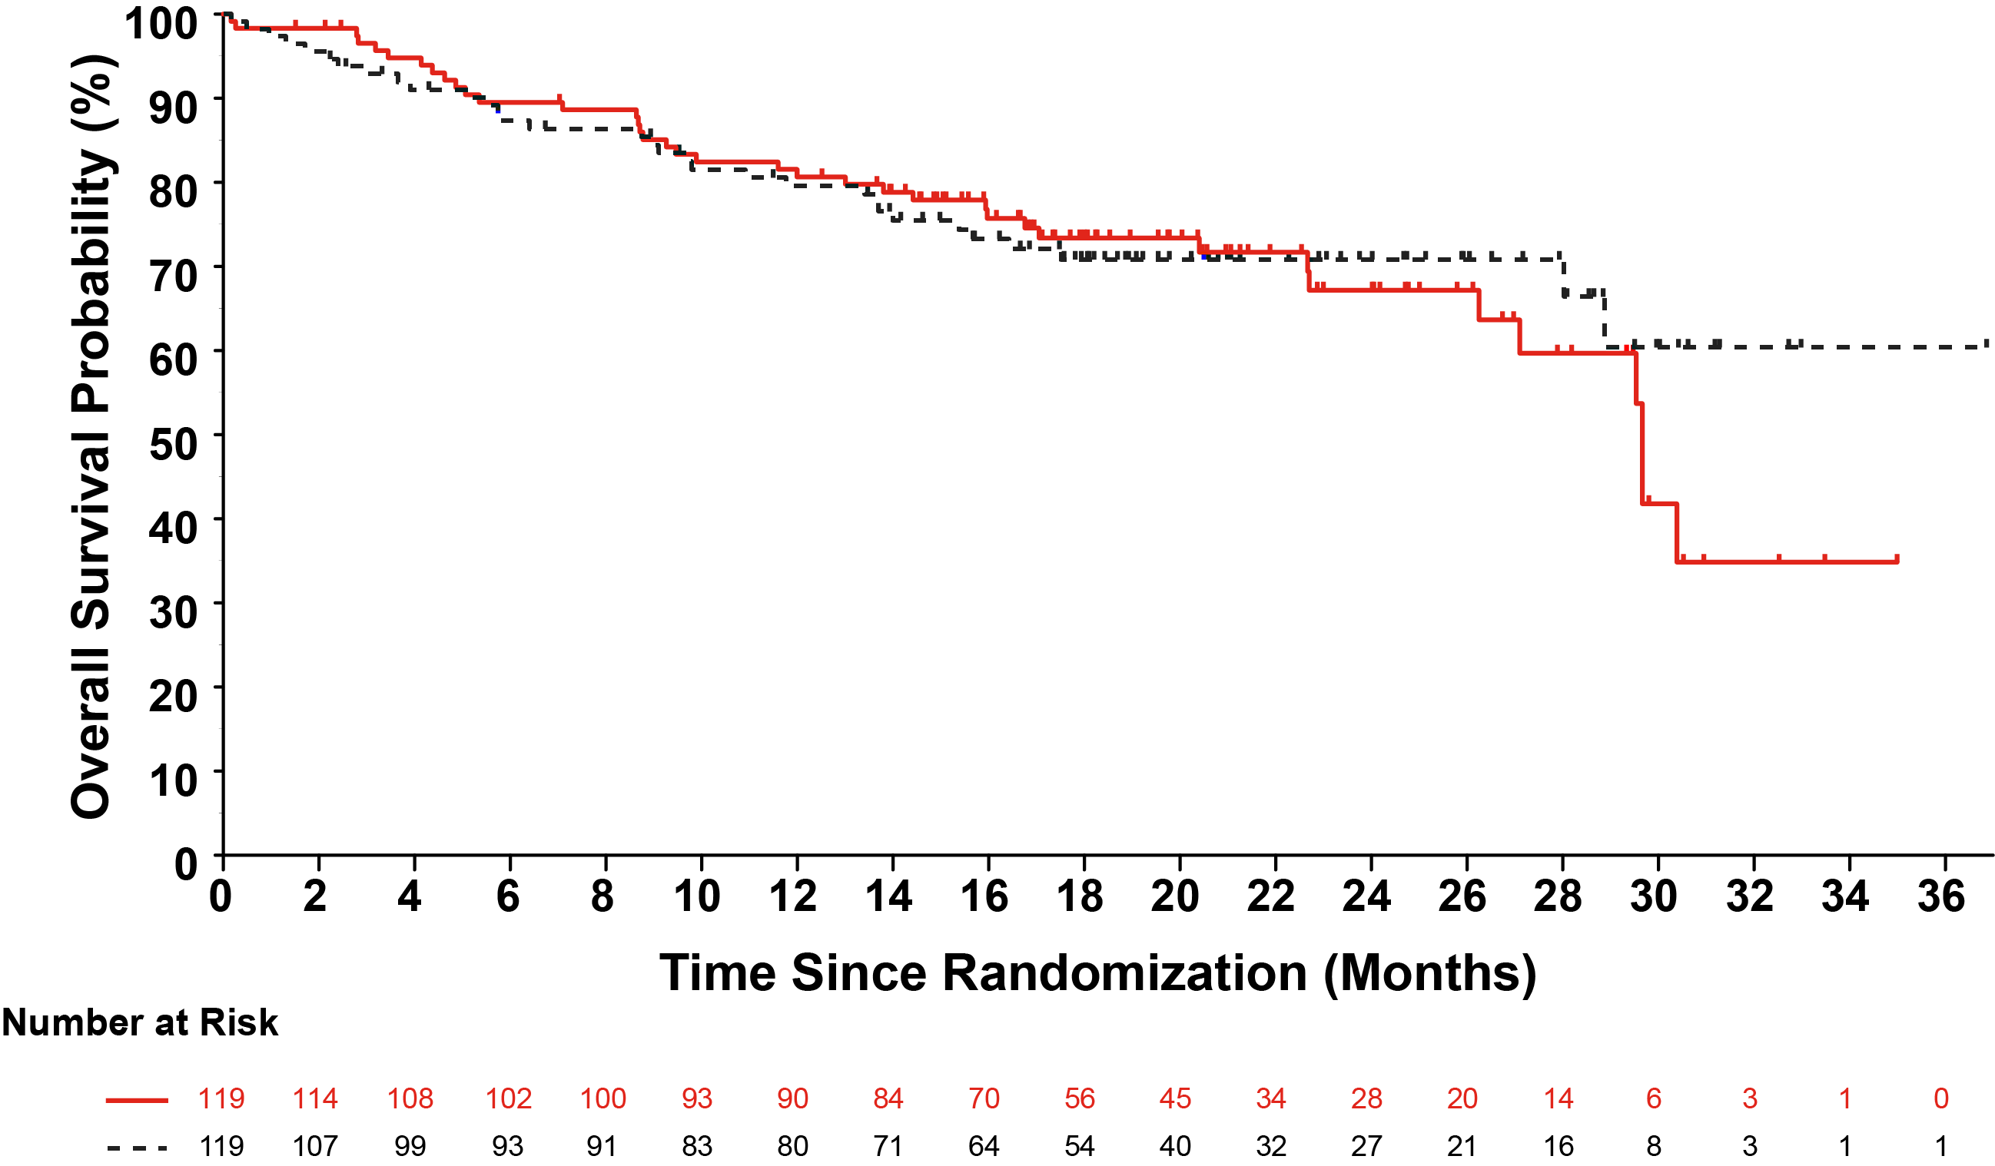
BRUIN CLL-321: Overall Survival
Pirtobrutinib
n=119
IdelaR/BR
n=119
Number of Events, n (%) | 38 (32) | 32 (27)
18-mo OS rate, % (95% CI) | 73.4 (63.9-80.7)​ | 70.8 (60.9-78.7)
Median follow-up, mo | 20.4 | 19.2
Hazard ratio (95% CI) | 1.09 (0.68-1.75)
Stratified log-rank 2-sided p-value | 0.7202
Pirtobrutinib
IdelaR/BR
Crossover Rate*: 76% (50/66)
IPCW crossover adjusted OS analysis:
HR 0.89 (95%CI, 0.52-1.53)
Two-stage AFT crossover adjusted OS analysis:
HR 0.77 (95%CI, 0.45-1.26)
Overall survival follow-up limited and confounded by high rate of post-progression crossover
*Defined as patients with investigator-defined PD events other than death. Abbreviations: BR, bendamustine + rituximab; CI, confidence interval; IdelaR, idelalisib + rituximab; IPCW, inverse-probability-of-censoring weighting; AFT, adjusted for treatment; mo, months; NE, not estimable; NR, not reached; OS, overall survival.
Sharman, et al., ASH 2024, Abstract #886
Notes:
The study was not powered to detect a difference in overall survival, which is shown is shown here. With relatively short follow up, no differences were demonstrated, however this analysis was confounded by over ¾ of subjects who crossed over to subsequent pirtobrutinib from investigators choice therapy.
Sensitivity analysis with adjustments for crossover demonstrated numerically improved although not statistically significant outcomes for patients treated with pirtobrutinib,

Slide 44
Adverse Events of Special Interest (AESI)
BRUIN CLL-321: Adverse Events of Interest for Pirtobrutinib
Adverse Events of Interest | Pirtobrutinib (n=116)
 | Any grade n (%) | Grade 3+ n (%)
Bleeding | 25 (21.6) | 4 (3.4)
Bruising | 9 (7.8) | 1 (0.9)
Petechiae and purpura | 6 (5.2) | 1 (0.9)
Hemorrhage | 18 (15.5) | 3 (2.6)
Anemia | 24 (20.7) | 13 (11.2)
Neutropenia | 31 (26.7) | 24 (20.7)
Thrombocytopenia | 11 (9.5) | 9 (7.8)
Infection | 74 (63.8) | 34 (29.3)
Infection without Covid-19 | 67 (57.8) | 30 (25.9)
Atrial fibrillation and atrial flutter | 3 (2.6)ª | 2 (1.7)
Hypertension | 8 (6.9) | 3 (2.6)
ª2 of 3 patients with atrial fibrillation had a past medical history of atrial fibrillation
Overall pirtobrutinib AESI rates were comparable to those seen in the Phase 1/2 BRUIN Study⁵
⁵Mato et al.NEJM 2023;389:33-44.
Sharman, et al., ASH 2024, Abstract #886
Notes:
Adverse events of special interest common to BTK agents are shown here.
Notably, subjects with atrial arrhythmias were not excluded from participation and cumulative event rates remained low. Furthermore, 2 of 3 subjects with treatment emergent atrial fibrillation had a history of prior a. fib. Hypertension was infrequent.

Slide 45
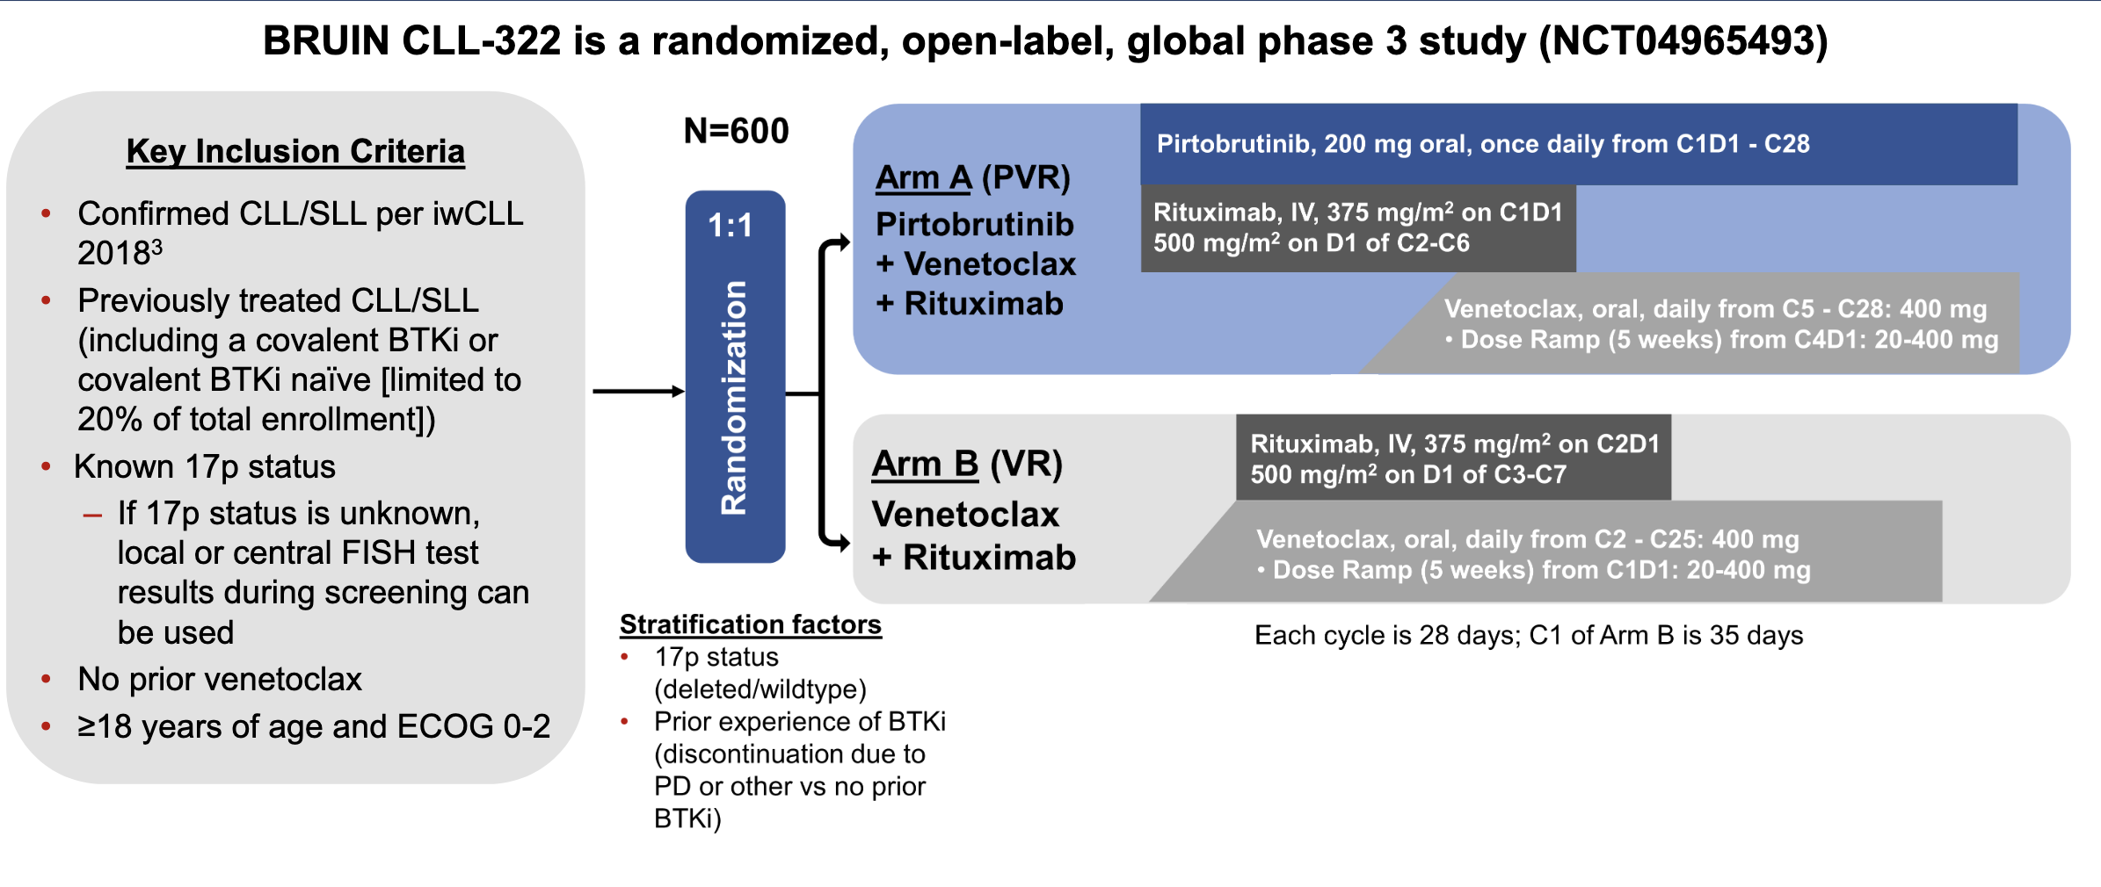
BRUIN CLL-322: A phase 3 open-label, randomized study of fixed duration pirtobrutinib plus venetoclax and rituximab versus venetoclax and rituximab in previously treated chronic lymphocytic leukemia/small lymphocytic lymphoma
Primary endpoint: PFS
Secondary endpoints: ORR, OS, TTNT, EFS, Safety, PROs
Eyre TA et al. ASCO 2023; Abstract TPS7583.
Mato AR et al. ASH 2021; Abstract 3742.

Slide 46
BRUIN CLL-314: A phase 3, open-label, randomized study of pirtobrutinib versus ibrutinib in patients with CLL/SLL
Primary Endpoints
– To establish non-inferiority of pirtobrutinib versus ibrutinib by comparing the overall
response rate per iwCLL 20182 criteria as assessed by IRC
Key Secondary Endpoints
– To determine the superiority of pirtobrutinib versus ibrutinib with respect to
IRC-assessed event-free survival and progression-free survival
Escalón MP et al. iwCLL 2023; Abstract 1548596.

Slide 47
BRUIN CLL-313: A phase 3 open-label, randomized study of pirtobrutinib versus bendamustine plus rituximab in untreated patients with CLL/SLL
Jurczak W et al. ASH 2021; Abstract 3732.

Slide 48
Cardiovascular Toxicity with BTKi
NG J et al. American College of Cardiology, 16 Aug, 2023.

Slide 49
TRANSCEND CLL 004: Demographics & Baseline
 | DL2 + ibrutinib set (n = 51) | Total liso-cel + ibrutinib combination set (n = 56)
Median (range) age, y | 65 (44—77) | 65 (44—77)
Median (range) prior lines of systemic therapy | 5 (1—13) | 5 (1—13)
≤ 3 prior therapies, n (%) | 19 (37) | 20 (36)
Prior BTKi, n (%) | 51 (100) | 56 (100)
Prior venetoclax, n (%) | 39 (76) | 42 (75)
Prior BTKi and venetoclax, n (%) | 39 (76) | 42 (75)
BTKi progression/venetoclax failure,ª n (%) | 28 (55) | 31 (55)
High-risk cytogenetics, n (%) | 50 (98) | 55 (98)
Del(17p) | 23 (45) | 25 (45)
Mutated TP53 | 23 (45) | 24 (43)
Unmutated IGHV | 37 (73) | 39 (70)
Complex karyotype^{b} | 25 (49) | 29 (52)
Bulky disease (≥ 5 cm) per INV before LDC,^{c} n (%)
Yes | 18 (35) | 18 (32)
Unknown | 4 (8) | 5 (9)
Median (range) SPD per INV before LDC,^{d} cm² | 29 (1—218) | 27 (1—218)
LDH ≥ ULN before LDC, n (%) | 22 (43) | 24 (43)
Received bridging therapy (in addition to ibrutinib),^{e} n (%) | 13 (25) | 16 (29)
Median (range) ibrutinib exposure was 34 days (15—188) before and 95 days (6—1517) after liso-cel in the total combination-treated set
Liso-cel was manufactured for 63/65 (97%) patients in the leukapheresed set
Median (range) time from leukapheresis to liso-cel availability was 25 (17—79) days (n = 62)
ªIncludes patients who progressed on a BTKi and met 1 of the following criteria: 1) discontinued venetoclax due to disease progression or intolerability and the patient’s disease met indications for further treatment per iwCLL 2018 criteria or 2) failed to achieve an objective response within 3 months of initiating therapy; ^{b}At least 3 chromosomal aberrations; ^{c}At least 1 lesion with a longest diameter ≥ 5 cm; ^{d}Forty-seven patients at DL2 and 51 patients in the total combination-treated set had SPD measurements; ^{e}Included other anticancer therapies in addition to concurrent ibrutinib treatment given for disease control during liso-cel manufacturing. IGHV, immunoglobulin heavy-chain variable region; LDC, lymphodepleting chemotherapy; SPD, sum of the product of perpendicular diameters.
Wierda W, et al. ASH 2024 TRANSCEND CLL 004: Liso-cel + Ibrutinib Cohort [Abstract #887]

Slide 50
Efficacy outcomes: response by investigator and uMRD4
Median (IQR) on-study follow-up (including LTFU): 24.8 months (14.2—34.6)
Median (range) time to first response: 1 month (0.9—6.0)
Median (range) time to first CR/CRi: 3 months (0.9—12.1)
Response by INV
uMRD4 rate
ORR
86%
95% CI, 74—94
96%
95% CI, 78—100
96%
95% CI, 78—100
86%
95% CI, 74—94
84%
95% CI, 71—93
CR/CRi rate 45%
95% CI, 31—60
n = 44
Patients with uMRD4, %
n = 22
n = 22
n = 22
n = 44
n = 44
n = 43
n = 22
n = 43
n = 23
n = 3
n = 4
n = 3
n = 4
DL2 + ibrutinib set (n = 51)
ªForty-nine patients (22 with CR/CRi) were evaluable for MRD in marrow.
Wierda W, et al. ASH 2024 TRANSCEND CLL 004: Liso-cel + Ibrutinib Cohort [Abstract #887]
Notes:
50

Slide 51
Progression-free survival by best overall response at DL2
Median (95% CI) follow-up for PFS: 24.3 months (23.7—35.5)
100
90
NR (29.6—NR)
80
% progression free (95% CI)
CR/CRi
70
60
31.4 (20.1—NR)
All DL2 patients
 | 12 months | 24 months
All DL2 patients (n = 51) | 76 (61—85) | 62 (46—74)
Patients with CR/CRi (n = 23) | 96 (73—99) | 85 (60—95)
Progression-free survival, %
3.2 (0.8—NR)
50
40
30
24.2 (11.9—42.3)
20
PR/nPR
10
0
Nonresponders
0
6
12
18
24
30
36
42
48
54
Time from liso-cel infusion, months
No. at risk
CR/CRi
23
23
22
20
12
7
5
4
2
0
PR/nPR
21
17
14
7
6
5
3
2
1
0
Nonresponders
7
0
0
0
0
0
0
0
0
0
All DL2 patients
51
40
36
27
18
12
8
6
3
0
Data on KM curves are expressed as median (95% CI). No formal landmarking analyses were conducted.
Wierda W, et al. ASH 2024 TRANSCEND CLL 004: Liso-cel + Ibrutinib Cohort [Abstract #887]
Notes:
51

Slide 52
Overall survival by best overall response at DL2
Median (95% CI) follow-up for OS: 26.8 months (24.1—31.6)
100
90
NR (27.5—NR)
80
CR/CRi
70
NR (27.5—NR)
% survival (95% CI)
60
 | 12 months | 24 months
All DL2 patients (n = 51) | 88 (75—94) | 80 (65—88)
Patients with CR/CRi (n = 23) | 100 (NR—NR) | 96 (73—99)
Overall survival, %
50
All DL2 patients
40
30
Nonresponders
20
PR/nPR
10.9 (3.6—NR)
42.3 (25.4—NR)
10
0
0
6
12
18
24
30
36
42
48
54
Time from liso-cel infusion, months
No. at risk
CR/CRi
23
23
23
22
17
9
6
5
2
0
PR/nPR
21
20
18
15
12
6
4
2
1
0
Nonresponders
7
3
1
1
0
0
0
0
0
0
All DL2 patients
51
46
42
38
29
15
10
7
3
0
Data on KM curves are expressed as median (95% CI). No formal landmarking analyses were conducted.
Wierda W, et al. ASH 2024 TRANSCEND CLL 004: Liso-cel + Ibrutinib Cohort [Abstract #887]
Notes:
52

Slide 53
Safety: incidence of CRS and NEs
14%
grade 1 (n = 8)
80%
36%
grade 1 (n = 20)
41%
16%
grade 2 (n = 9)
CRS^{a,b}
NEs^{a,c}
any grade
(n = 45)
41%
grade 2 (n = 23)
any grade
(n = 23)
9%
grade 3 (n = 5)
4%
grade 3 (n = 2)
2%
grade 4 (n = 1)
No grade 4 or 5 events
No grade 5 events
 | Total combination-treated set (n = 56)
Median (range) days to CRS onset | 7 (1—14)
Median (range) days to CRS resolution | 5 (2—18)
Received tocilizumab and/or corticosteroids for CRS and/or NE, n (%) | 33 (59)
 | Total combination-treated set (n = 56)
Median (range) days to NE onset | 8 (1—15)
Median (range) days to NE resolution | 8 (1—362)
Received tocilizumab and/or corticosteroids for CRS and/or NE, n (%) | 33 (59)
ªSummed percentages for grouped grades within each graph may not equal the any-grade percentage due to rounding; ^{b}CRS was graded based on Lee 2014 criteria; ^{c}NEs were defined as –INV-identified neurological AEs related to liso-cel.
Wierda W, et al. ASH 2024 TRANSCEND CLL 004: Liso-cel + Ibrutinib Cohort [Abstract #887]

Slide 54
Agenda
Module 1: Selection and Sequencing of Therapy for Relapsed/Refractory (RR) Chronic Lymphocytic Leukemia (CLL) — Dr Wierda
Module 2: First-Line Therapy for CLL — Dr Coombs
Module 3: Novel Agents and Strategies for RR CLL — Dr Wierda
Module 4: ASCO and EHA 2025

Slide 55
Regulatory and reimbursement issues aside, outside of a clinical trial, have you or would you administer a BTKi inhibitor in combination with venetoclax +/- an anti-CD20 antibody as first-line treatment for CLL? If you were going to administer a BTKi in combination with venetoclax +/- an anti-CD20 antibody as first-line treatment for CLL, which would be your preferred BTKi?
BTK inhibitor + venetoclax +/- anti-CD20 antibody
Preferred BTK inhibitor
I have
Acalabrutinib
I have
Ibrutinib
I have
Zanubrutinib
I have
Acalabrutinib
I haven’t but would for the right patient
Acalabrutinib
I haven’t but would for the right patient
Zanubrutinib

Slide 56
Regulatory and reimbursement issues aside, in what specific clinical situations would you prefer to administer the time-limited regimen of a BTK inhibitor in combination with venetoclax with or without an anti-CD20 antibody as first-line therapy for CLL?
AV: pt desiring time limited but prefers all oral AVO: pt desiring time limited with higher-risk markers
This is my preferred first-line treatment approach
Bulky unmutated IGHV del(17p) or del(11q) CLL
AV: older pts/those with comorbidities and low-risk genetics
AVO: younger or fit pts/those with higher-risk genetics desiring time-limited therapy
Bulky nodes, higher risk for TLS, patient preference
Younger patient, high-risk cytogenetics, desire for fixed-duration therapy but not keen on multiple infusions
AV = acalabrutinib and venetoclax; AVO = acalabrutinib, venetoclax and obinutuzumab; TLS = tumor lysis syndrome

Slide 57
Regulatory and reimbursement issues aside, and assuming equal access to acalabrutinib, zanubrutinib and pirtobrutinib, in general, which BTK inhibitor would you prefer to administer as first-line treatment for CLL?
Zanubrutinib
Acalabrutinib or zanubrutinib
Zanubrutinib
Acalabrutinib
Zanubrutinib
Zanubrutinib

Slide 58
Regulatory and reimbursement issues aside, what would be your preferred initial regimen for a patient with CLL and an IGHV mutation and no del(17p) or TP53 mutation requiring treatment?
60-year-old patient
80-year-old patient
Venetoclax + obinutuzumab
Venetoclax + obinutuzumab
Venetoclax + obinutuzumab
Venetoclax + obinutuzumab
Venetoclax + obinutuzumab
Zanubrutinib
Venetoclax + obinutuzumab
Venetoclax + obinutuzumab
Venetoclax + obinutuzumab
Venetoclax + obinutuzumab
Venetoclax + obinutuzumab
Venetoclax + obinutuzumab

Slide 59
Regulatory and reimbursement issues aside, what would be your preferred initial regimen for a patient with CLL and no IGHV mutation or del(17p) or TP53 mutation requiring treatment?
60-year-old patient
80-year-old patient
Venetoclax + obinutuzumab
Zanubrutinib
Ibrutinib + venetoclax
Acalabrutinib + venetoclax; acalabrutinib + venetoclax + obinutuzumab
Zanubrutinib + venetoclax + obinutuzumab
Zanubrutinib
Venetoclax + obinutuzumab
Venetoclax + obinutuzumab
Acalabrutinib + obinutuzumab
Zanubrutinib
Venetoclax + obinutuzumab
Zanubrutinib

Slide 60
Regulatory and reimbursement issues aside, what would be your preferred initial regimen for a patient with CLL and no IGHV mutation but with a del(17p) or TP53 mutation requiring treatment?
60-year-old patient
80-year-old patient
Zanubrutinib
Zanubrutinib
Ibrutinib + venetoclax
Acalabrutinib or zanubrutinib
Zanubrutinib + venetoclax + obinutuzumab → zanubrutinib
Zanubrutinib
Zanubrutinib
Zanubrutinib
Zanubrutinib + venetoclax
Zanubrutinib
Zanubrutinib + venetoclax
Zanubrutinib

Slide 61
First-line therapy for chronic lymphocytic leukemia
Callie Coombs, MD
Associate Clinical Professor
University of California Irvine

Slide 62
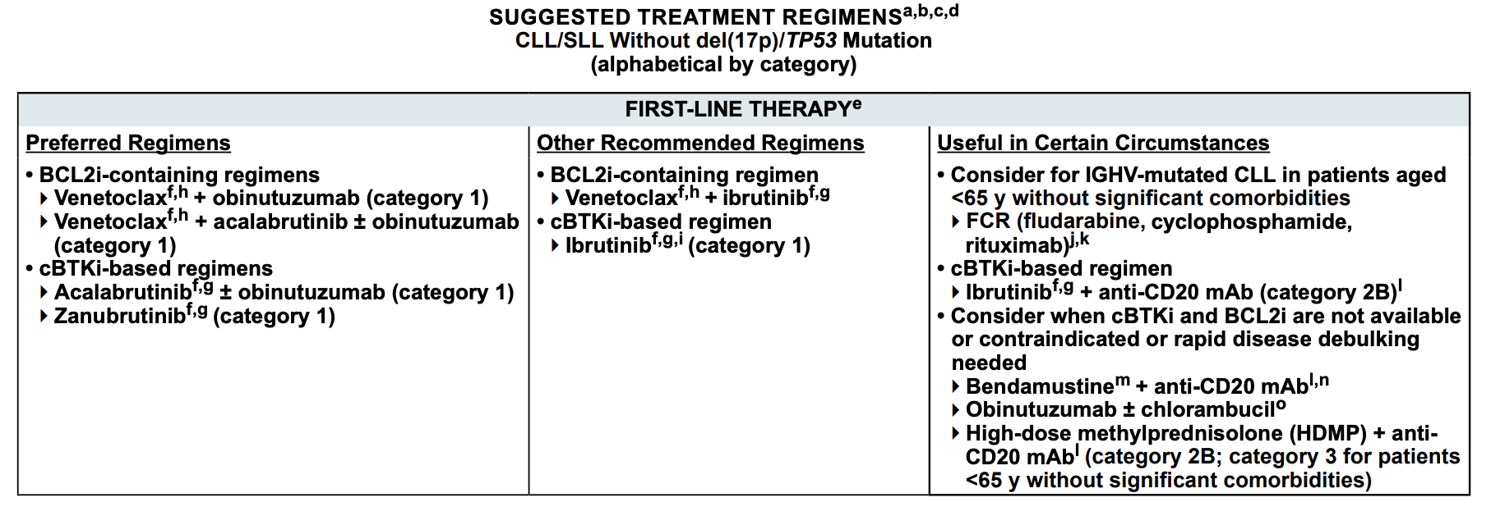
What do the guidelines say?
Guidelines for patients with 17p/TP53 mutation are similar but advise against CIT (and no category 1 regimens in first-line)
NCCN guidelines – Accessed 5/24/25

Slide 63
Ibrutinib provides long-term disease control
With up to 10-years of follow up from RESONATE-2 trial demonstrates median PFS of 8.9 years for ibrutinib-treated patients compared to 1.3 years for chlorambucil-treated patients
Burger J et al. EHA 2024

Slide 64
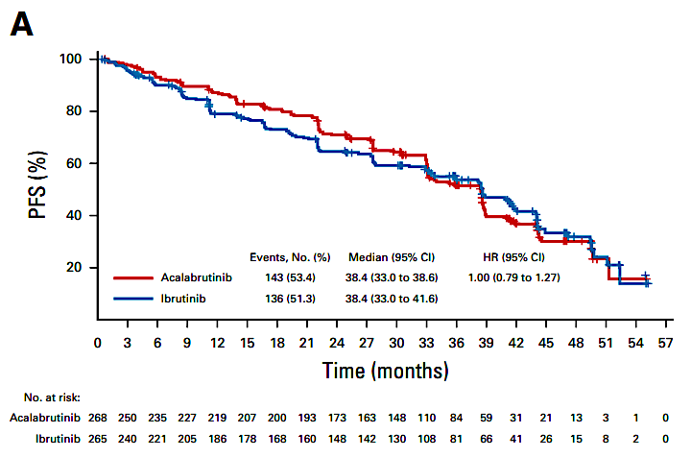
Ibrutinib is no longer a favored BTKi due to toxicity profile
ELEVATE-RR: Acalabrutinib has non-inferior efficacy to ibrutinib in high-risk relapsed population, but superior safety ⬇️afib/flutter, ⬇️HTN
ALPINE: Zanubrutinib has superior efficacy vs. ibrutinib in all-comer relapsed population, also superior safety ⬇️afib/flutter, but similar HTN
Byrd et al. JCO 2021 and Brown et al. ASH 2023

Slide 65
ELEVATE TN: Study Design
Acalabrutinibª + Obinutuzumab (G)^{b}
ª100 mg PO BID
^{b}1000 mg IV on days1, 2, 8, and 15 of cycle 2, + day 1 of subsequent 28-day cycles for a total of 6 cycles
Treatment-naive CLL (N=535)
Age ≥65 years or
<65 years with coexisting conditions
CIRS score >6, or
CrCl <70 mL/min
Stratification
del(17p), y vs n
ECOG PS 0-1 vs 2
Geographic region (N America, W Europe, or other)
Primary endpoint
PFS (assessed by IRC) Acala-G vs G-Clb
Key secondary endpoints
PFS acalabrutinib vs G-Clb
ORR (assessed by IRC and investigator)
Time to next treatment
OS
Safety
RANDOMIZE
Acalabrutinib
100 mg PO BID
Obinutuzumab (G)^{c} + Chlorambucil^{d}
^{c}1000 mg IV on days 1, 2, 8, and 15 of cycle 1, + day 1 of subsequent 28-day cycles for a total of 6 cycles
^{d}0.5 mg/kg PO on day 1 + 15 of each 28-day cycle for 6 cycles
1:1:1
Crossover from G-Clb to acalabrutinib was allowed after IRC-confirmed progression
Interim analysis was planned based on events (after occurrence of ~111 IRC-assessed PFS events in the combination therapy arms) or after 24 months if the required number of events was not met by this time
Sharman JP et al. Lancet. 2020;395(10232):1278-91.

Slide 66
Median PFS was significantly higher for A-containing arms vs O+Clb
100
78%
80
Median PFS=NR
A+O vs O+Clb
HRª (95% CI): 0.14 (0.10, 0.20); P<0.0001^{b}
A vs O+Clb
HRª (95% CI): 0.24 (0.17, 0.32); P<0.0001^{b}
A+O vs A
HRª (95% CI): 0.58 (0.39, 0.86); P=0.0229^{b}
60
62%
Progression-Free Survival, %
Median PFS=NR
40
17%
Median PFS=27.8 mo
20
A+O
A
0
O+Clb
0
3
6
9
12
15
18
21
24
27
30
33
36
39
42
45
48
51
54
57
60
63
66
69
72
75
78
81
84
87
90
Months
No. at risk
A+O
A
O+Clb
179 | 175 | 170 | 168 | 164 | 163 | 160 | 157 | 156 | 156 | 153 | 152 | 151 | 146 | 144 | 141 | 140 | 138 | 136 | 133 | 127 | 124 | 119 | 116 | 99 | 54 | 39 | 25 | 10 | 2 | 0
179 | 167 | 163 | 158 | 156 | 155 | 153 | 150 | 149 | 146 | 142 | 141 | 137 | 135 | 133 | 130 | 129 | 124 | 121 | 115 | 113 | 103 | 100 | 95 | 85 | 56 | 37 | 22 | 7 | 2 | 0
177 | 163 | 156 | 153 | 139 | 125 | 110 | 100 | 86 | 82 | 67 | 66 | 56 | 49 | 44 | 41 | 38 | 30 | 29 | 28 | 24 | 21 | 21 | 18 | 14 | 8 | 6 | 3 | 1 | 0 | 0
Median PFS was significantly higher for A+O vs A
ªHazard ratio based on stratified Cox proportional-hazards model.
^{b}P-value based on stratified log-rank test.
Sharman et al. ASH 2023
Notes:
The PFS is shown here with 78%, 62%, and 17% free from progression at 6 years. Comparing the two acalabrutinib arms in a post hoc analysis, the difference of 16% resulted in a hazard ratio of 0.58 with a p value of 0.02

Slide 67
SEQUOIA study design
Arm A: zanubrutinib 160 mg bid until PD, intolerable toxicity, or end of study
(n=241)
Cohort 1 without del(17p) by central FISH
Open label
Key eligibility criteria
Untreated CLL/SLL
Met iwCLL criteria for treatment
≥65 y or ≥18 y of age and unsuitable for treatment with FCRª
Anticoagulation and CYP3A inhibitors allowed
R 1:1
Arm B: bendamustine (90 mg/m² D1 and D2) + rituximab (375 mg/m² C1, then 500 mg/m² C2-C6) for 6 cycles
(n=238) Patients who had centrally confirmed PD could cross over to receive zanubrutinib
Stratification factors Age, Binet stage, IGHV status, geographic region
Cohort 2 with del(17p)
Arm C: zanubrutinib 160 mg bid until PD, intolerable toxicity, or end of study
(n=111)^{b}
ClinicalTrials.gov NCT03336333
Assessments
Response assessments were conducted every 12 weeks from start of C1 for 96 weeks and every 24 weeks until PD
CR/CRi confirmed via bone marrow biopsy
AEs documented until PD or start of next CLL therapy
Statistical analysis
Efficacy endpoints analyzed using ITT analysis and the per-protocol analysis set
Safety was assessed in all pts who received ≥1 dose of treatment
Outcomes
PFS assessed by investigator
OS in cohorts 1 and 2
PFS 2^{c}
Clinical outcomes (correlated with baseline prognostic and predictive markers)
Safety

Slide 68
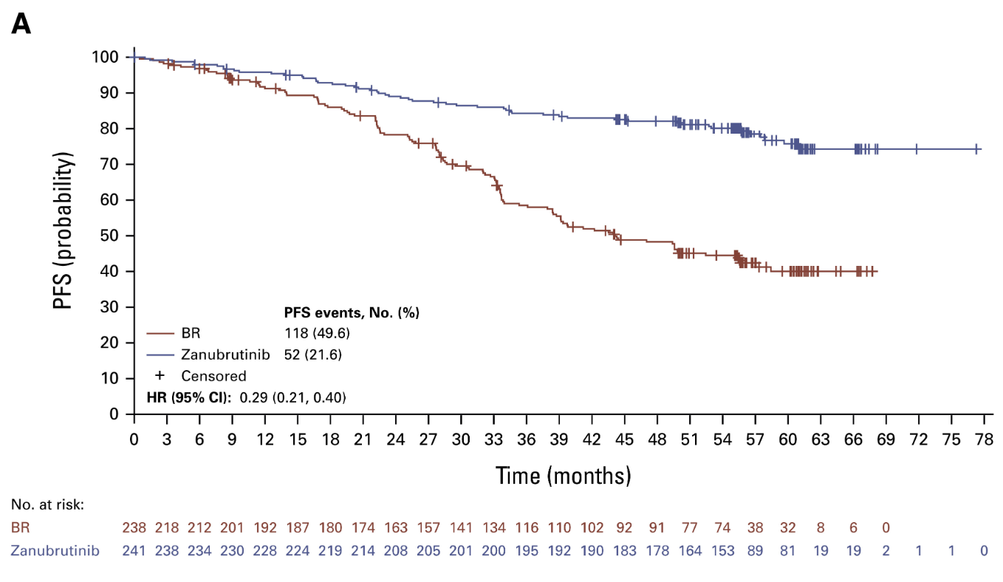
5-year SEQUOIA follow up
Shadman M et al. JCO 2024

Slide 69
Phase III CLL14 Study: 6-Year Update
Study Design
Investigator Assessed Progression-Free Survival
Venetoclax- Obinutuzumab
6 cycles
Venetoclax
6 cycles
Previously untreated patients with CLL and coexisting medical conditions
CIRS > 6 and/or CrCl < 70mL/min
Enrollment from 2015 to 2016
Follow-up Phase
Primary endpoint:
PFS
Key secondary endpoints:
Response, MRD, OS
Median PFS
Ven-Obi: 76.2 months
Clb-Obi: 36.4 months
6-year PFS rate
Ven-Obi: 53.1%
Clb-Obi: 21.7%
HR 0.40, 95% CI [0.31-0.52]
P<0.0001
1:1
randomization
End of treatment
Ven-Obi
Clb-Obi
Chlorambucil-Obinutuzumab
6 cycles
Chloram -bucil
6 cycles
6-Year OS rate = 78%
Reformatted from Al-Sawaf et. al. EHA 2023. Presentation ID S145
Notes:
Coombs

Slide 70
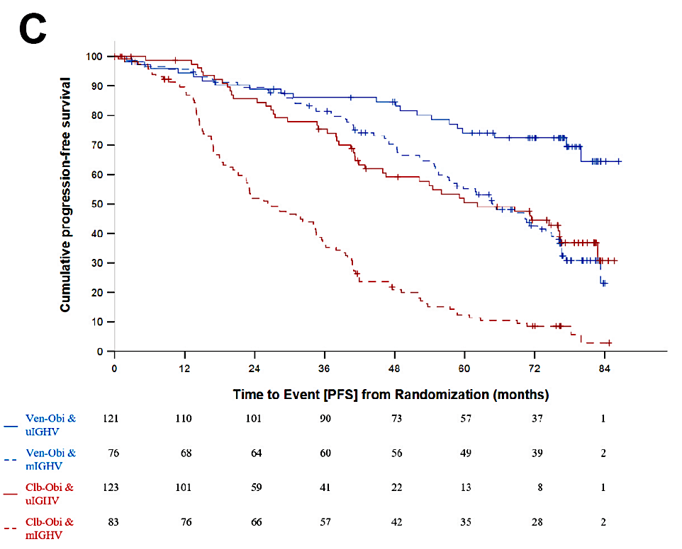
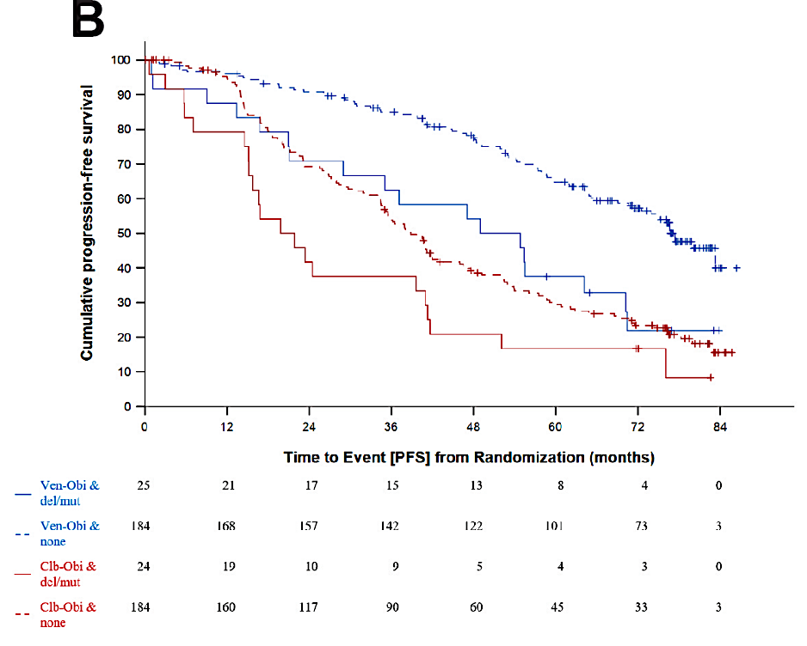
Venetoclax in frontline setting: CLL14 trial
Updates from 6 year follow up:
Median PFS reached: 76.2 months
Median PFS for TP53 aberrant pts: 51.9 months
Median PFS for unmut IGHV pts: 64.8 months
Al-Sawaf O et al. EHA 2023

Slide 71
GAIA/CLL13 Study Design for Fit Patients With CLL
Chemoimmunotherapy (FCR/BR) vs Rituximab + Venetoclax vs Obinutuzumab (G) + V vs G + Ibrutinib + V
Recruitment in 10 countries (DE, AT, CH, NL, BE, DK, SE, FI, IE, IL)
Fit patients with CLL:
CIRS ≤6 and normal CrCl
No TP53 mutation or del(17p) in central screening
Stratification according to age, stage, and region
Randomization
CIT: FCR/BR*
230
RV
230
GV
230
Co-primary endpoint (α 2.5%)
uMRD at month 15
GIV
230
Co-primary endpoint
(α 2.5%)
PFS interim analysis
*≤65 years: FCR
>65 years: BR
920 patients
CIRS = Cumulative Illness Rating Scale; CIT = chemoimmunotherapy; uMRD = undetectable minimal residual disease
[50% FCR/50% BR]
Eichhorst B et al. 2022 EHA; Abstract LB2365.

Slide 72
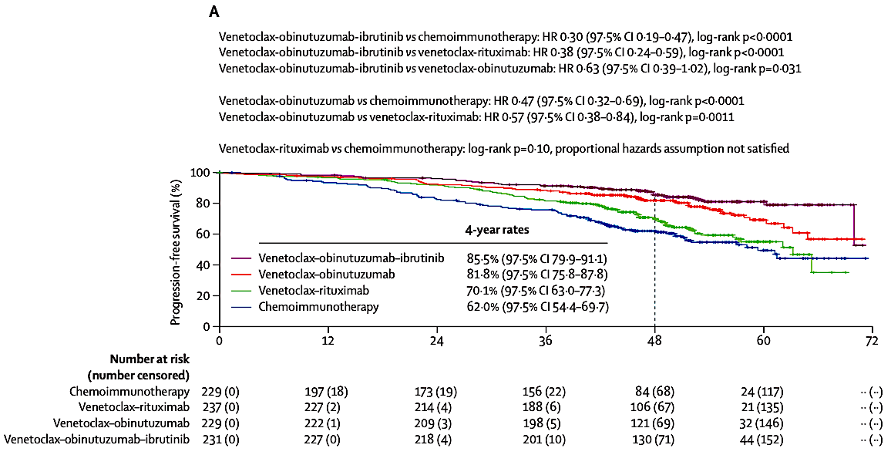
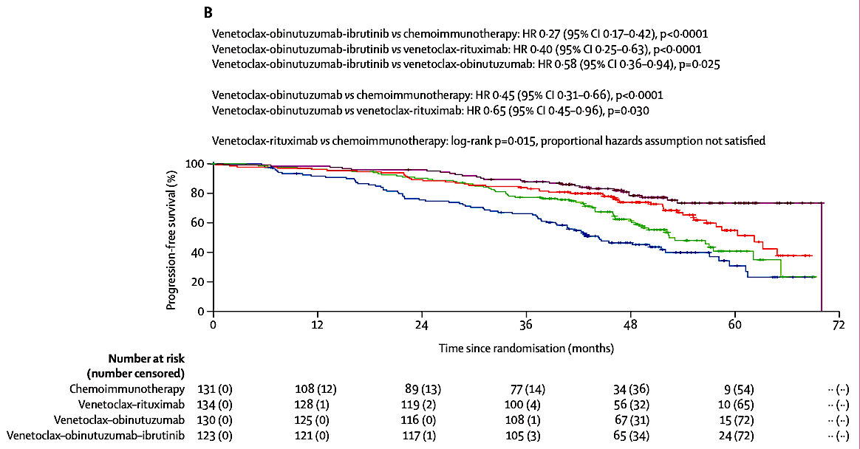
4-year follow up of CLL13 trial support VO-containing regimen superiority
Unmutated IGHV only
Fürstenau M et al. Lancet Oncol. 2024

Slide 73
Rationale to combine BTKi with BCL2i
Lymph Node
BTKi mobilize
CLL cells out of protective lymphoid niches and inhibits proliferation
BTKi accelerate
apoptotic cell killing by sensitizing CLL cells to BCL-2 inhibition
Stromal cell
BTKi
Venetoclax
BTKi
BTKi + BCL2i eliminate
resting and dividing CLL cell subpopulations
Peripheral Blood
Eliminate
resting and dividing CLL cell subpopulations
Dividing CLL cells
Resting CLL cells
x
x
Apoptotic CLL cells
x
Dead CLL cells
x
x
1. Lu P et al. Blood Cancer J. 2021; 11:39; 2. Deng J et al. Leukemia. 2017; 31:2075-2084; 3. Herman ES et al. Clin Cancer Res. 2015; 21:4642-4651; 4. Burger JA et al. Leukemia. 2020;34:787-798; 5. Shanafelt T et al. N Engl J Med. 2019;381:432-443; 6. Cervantes-Gomez, F. et al. Clin. Cancer Res. 2015; 21:3705–3715; 7. Slinger E, et al. Blood. 2017; 130: 3018-3018; 8. Haselager MV, et al. Blood. 2020 ;136:2918-2926; 9. Slinger E et al. Leukemia. 2017 Dec;31(12):2601-2607.

Slide 74
AMPLIFY: Combination cBTKi and BCL2i Therapy in 1L CLL
AMPLIFY
Treatment-naive CLL
Age ≥ 18y/o
ECOG: 0-2
Active disease per IWCLL 2018 criteria
Exclusion
del(17p), TP53
RANDOMIZE
1:1:1
Acalabrutinib + Venetoclax
Acalabrutinib + Venetoclax + Obinutuzumab
Chemo/IO (FCR or BR)
Primary endpoint: PFS (assessed by IRC)
AVO
83.1%
36-mo OS
94.1%
87.7%
85.9%
FCR/BR
AVO
AV
76.5%
FCR/BR
66.5%
AV
 | HR (95% CI) | P value
AV vs FCR/BR | 0.65 (0.49 to 0.87) | P = 0.0038
AVO vs FCR/BR | 0.42 (0.30 to 0.59) | P<0.0001
 | HR (95% CI) | P value
AV vs FCR/BR | 0.33 (0.18 to 0.56) | P<0.0001
AVO vs FCR/BR | 0.76 (0.49 to 1.18) | -
Patients at Risk
AV | 291 | 282 | 269 | 251 | 237 | 219 | 177 | 102 | 35 | 3 | 0
AVO | 286 | 272 | 258 | 237 | 225 | 219 | 191 | 116 | 51 | 7 | 0
FCR/BR | 290 | 236 | 208 | 189 | 170 | 154 | 127 | 66 | 28 | 6 | 0
Patients at Risk
AV | 291 | 286 | 281 | 277 | 275 | 270 | 233 | 142 | 58 | 10 | 0
AVO | 286 | 276 | 265 | 257 | 252 | 250 | 223 | 143 | 64 | 10 | 0
FCR/BR | 290 | 247 | 236 | 228 | 223 | 217 | 182 | 98 | 45 | 13 | 0
Median PFS was NR for AV and AVO, and was 47.6 mo for FCR/BR
Brown, JR et. al. Blood. 2024; 144: abstract 1009.
Notes:
Coombs

Slide 75
AMPLIFY: Secondary Endpoints
uMRD Rates (Flow Cytometry [<10⁻⁴] in PB)
Evaluable Patients†
No. of patients | 244 | 202 | 190 |  | 222 | 202 | 181 |  | 229 | 197 | 190
Same Timepoint as Key Secondary Endpoint
EOT
EOT+3
Key secondary endpoint timing: cycle 9, day 1 (AV arm), cycle 10, day 1 (AVO arm), and cycle 6, day 1 plus 12 weeks (FCR/BR)
PFS in the uMRD Subgroup at EOT (Flow Cytometry [<10⁻⁴] in PB)
PFS in the MRD+ Subgroup at EOT (Flow Cytometry [<10⁻⁴] in PB)
90.4%
87.1%
AVO uMRD
AV uMRD
72.2%
 | HR (95% CI)
AV vs FCR/BR (uMRD) | 0.43 (0.24 to 0.76)
AVO vs FCR/BR (uMRD) | 0.27 (0.16 to 0.46)
74.8%
 | HR (95% CI)
AV vs FCR/BR (MRD+) | 0.44 (0.28 to 0.71)
AVO vs FCR/BR (MRD+) | 0.70 (0.21 to 1.78)
66.7%
AV MRD+
 | Events/N | Median (mo)
AV uMRD | 18/100 | NR
AVO uMRD | 22/192 | NR
FCR/BR uMRD | 40/132 | 49.2
FCR/BR uMRD
 | Events/N | Median (mo)
AV MRD+ | 46/122 | NR
AVO MRD+ | 5/10 | 45.7
FCR/BR MRD+ | 29/49 | 35.3
45.2%
FCR/BR MRD+
AVO MRD+
Brown, JR et. al. Blood. 2024; 144: abstract 1009.
Notes:
Coombs

Slide 76
Brown, JR et. al. Blood. 2024; 144: abstract 1009.

Slide 77
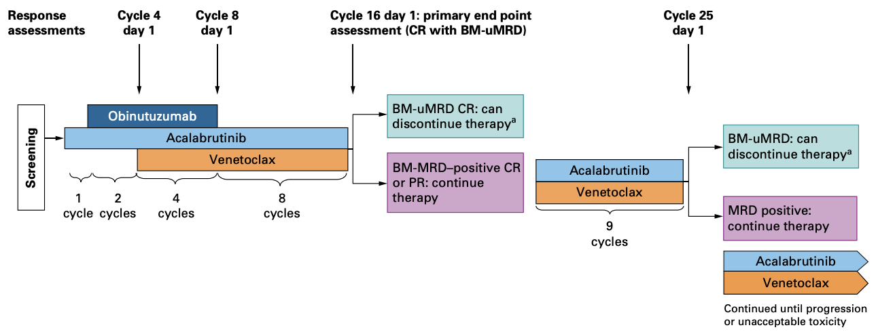
AVO in patients with TP53 aberrations?
Davids MS et al, JCO 2024

Slide 78
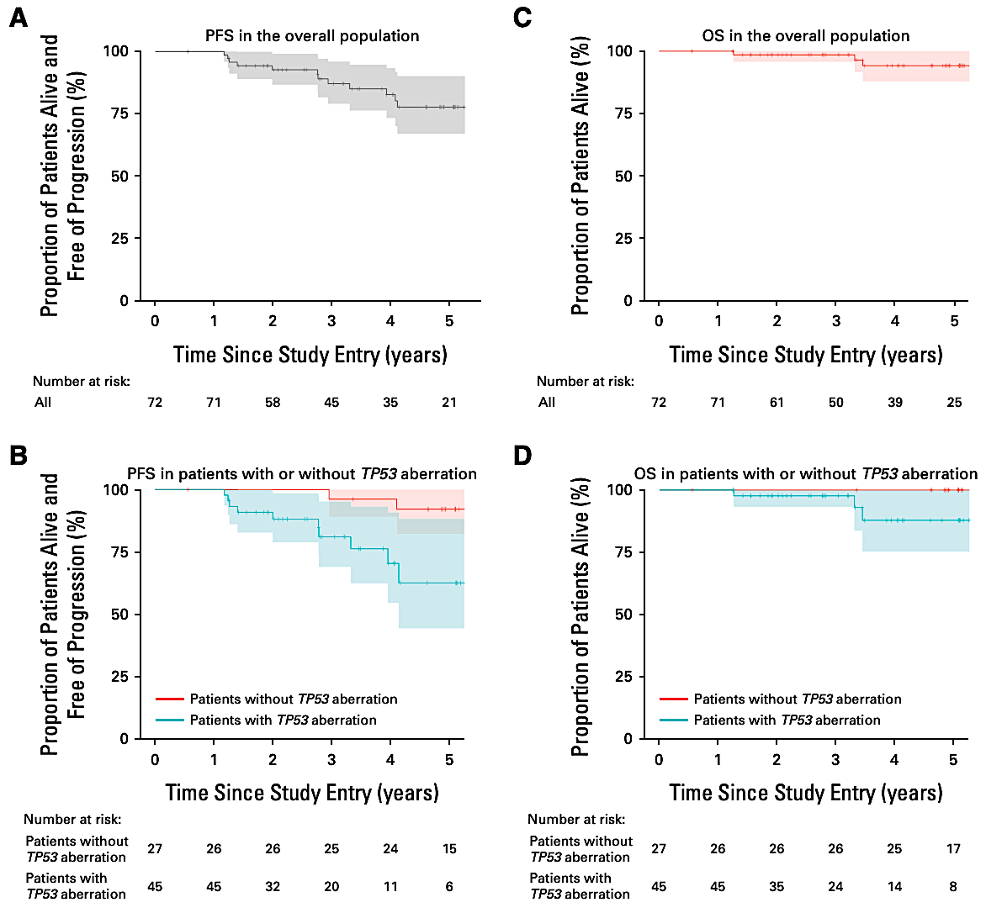
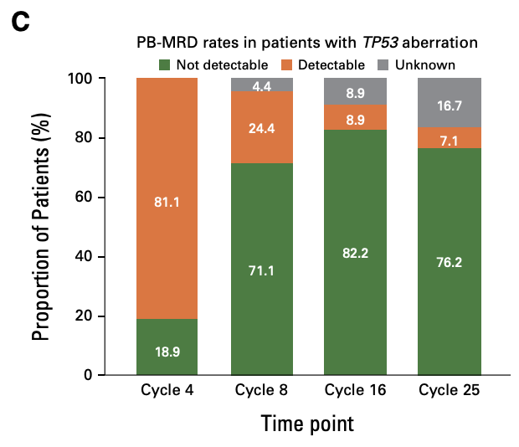
AVO remains highly effective in high-risk patients
Davids MS et al, JCO 2024

Slide 79
MAJIC Study Design
Arm A
Acalabrutinib (A) 100 mg po BID,
Venetoclax (V) 400 mg po daily (C3D1-C14), including 5 week ramp up
STOP if uMRD and at least PR. If MRD+ continue AV to 24 months
Arm B
Venetoclax (V) 400 mg po daily (C1D22-C12), including 5 week ramp up
Obinutuzumab (O) 1000 mg iv. (C1D1-2/8/15, C2-6 D1)
STOP if uMRD and at least PR. If MRD+ continue V to 24 months
PB MRD (clonoSEQ & flow)
BM MRD (flow)
STOP
Arm A
C15D1
stop if uMRD
A
V
Screen
Randomization 1:1
Arm B
C13D1
V
stop if uMRD
O
Ryan, C. E., Davids, M. S., Hermann, R., Shahkarami, M., Biondo, J., Abhyankar, S., … Roeker, L. E. (2022). MAJIC: A Phase III Trial of Acalabrutinib + Venetoclax versus Venetoclax + Obinutuzumab in Previously Untreated Chronic Lymphocytic Leukemia or Small Lymphocytic Lymphoma. Future Oncology, 18(33), 3689–3699.

Slide 80
BGB-11417-101: Phase 1/2 Evaluating Sonrotoclax + Zanu
Study Design
Sonrotoclax + zanubrutinib dose -finding (weekly/daily ramp-up)
Sonrotoclax + zanubrutinib expansion
R/R CLL/SLL, MCL, TN CLL/SLL
R/R CLL/SLL, MCL, TN CLL/SLL
640 mg
320 mg
160 mg and 320 mg selected for expansion
320 mg
160 mg
160 mg
80 mg
40 mg
8 to 12 weeks of zanubrutinib monotherapy was given prior to sonrotoclax dosing (12 weeks if high tumor burden)
Sonrotoclax was dosed orally, once daily, using a weekly or daily ramp-up schedule to reach the target dose
TN CLL/SLL
Responses
Best Responseª
Best Blood MRDª
By Week 24
By Week 48
By Week 24^{b}
By Week 48^{b}
Reformatted from Soumerai et. al. ASH 2024. Oral Presentation. Abstract 1012.

Slide 81
More to come on Zanu + Sonrotoclax in the 1L
CELESTIAL-TNCLL Study Design
Key Eligibility Criteria
Study Design
Endpoints
Age 18 years and above
Confirmed CLL diagnosis, no previous treatment
Measurable disease by CT/MRI
ECOG PS of 0-2
Adequate BM and organ function
No history of, or currently suspected, Richter's transformation
Zanubrutinib lead-in (3 cycles) followed by Sonrotoclax + Zanubrutinib (12 cycles) (n~320)
Primary
PFS (IRC; iwCLL 2018^{[5]})
Secondary
CRR^{[a]} (IRC and INV)
Rates of uMRD4 (BM and PB)^{b}
OS
PFS (INV)
ORR (IRC and INV)
DOR (IRC and INV)
Patient-reported outcomes
Safety and tolerability
Arm A
Previously untreated CLL (N~640)
R 1:1
Venetoclax (12 cycles) + Obinutuzumab (6 cycles) (n~320)
Randomization stratified by:
Age (<65 vs ≥65 years)
IGHV status
Del(17p)/TP53 mutation status
Arm B
ª Defined as CR or CR with incomplete recovery. ^{b} At[<10⁴ sensitivity at the first post-treatment follow-up based on next-generation sequencing by clonoSEQ® and flow cytometry. BM, bone [marrow]; CRR, complete [response] rate; DOR, duration of response; INV, assessed by investigator; IRC, assessed by independent review committee; PB, [peripheral] blood, R, randomized; TN, treatment naive; uMRD4, undetectable measurable residual disease.
Shadman et.al. ASCO 2024. Poster 68a.

Slide 82
Approved Treatments in Frontline CLL: Pros and Cons
Ibrutinib
Acalabrutinib/Zanubrutinib
Venetoclax + Obinutuzumab (VO), Acala-Ven (AV), Acala-Ven-Obin (AVO)
Pro
Longest follow-up
Median PFS 8.9 years from RESONATE-2 trial
Once daily oral drug
Con
Indefinite duration
Low CR/uMRD
Atrial fibrillation, bleeding
Pro
Reduced off-target effects lead to improved safety vs. ibrutinib
Zanubrutinib with superior efficacy vs. ibrutinib (in relapsed setting)
Con
Shorter follow-up
Indefinite duration
Low CR/uMRD
Atrial fibrillation, bleeding
Pro
Time-limited
High CR/uMRD (VO/AVO likely > AV)
Con
Shorter follow-up
TLS logistics
IV administration of obinutuzumab aside from AV
Neutropenia, infection risk
Shorter remissions in del(17p)/TP53-m with VO (not included in AMPLIFY trial)
Barr PM, et al. Blood Adv. 2022;6:3440-3450. O’Brien SM, et al. Front Oncol. 2021; 11: 720704. Brown JR, et al. N Engl J Med. 2025;392:748-762.
Notes:
Coombs

Slide 83
Conclusions
There are several effective first-line therapies in CLL
Likely will not have a “one-size-fits-all” first-line regimen
Shared decision making hugely important to select the best therapy for any given patient

Slide 84
Agenda
Module 1: Selection and Sequencing of Therapy for Relapsed/Refractory (RR) Chronic Lymphocytic Leukemia (CLL) — Dr Wierda
Module 2: First-Line Therapy for CLL — Dr Coombs
Module 3: Novel Agents and Strategies for RR CLL — Dr Wierda
Module 4: ASCO and EHA 2025

Slide 85
New Agents for Relapsed/Refractory CLL
Old targets:
BTK only degrader (bexobrutideg [NX-5948]; BGB-16673; ABBV-101)
ncBTKi (nemtabrutinib; TT-01488; LP-168)
ngBCL2i (lisaftoclax; sonrotoclax; ABBV-453)
CD20xCD3 bispecifics (mosunetuzumab; epcoritamab; glofitamab; odronextamab)
New targets:
BCL-xL/BCL-2 – (LP-118)
PKCβ inhibitor – (MS-553)
MALT1 (ABBV-525)
ROR1 (xCD3 bispecific; CAR-T cells)

Slide 86
Epcoritamab in CLL: Deep Responses Across Subgroups
Response, n (%) | EXP mFU: 22.8 months |  |  |  |  | C1 OPT mFU: 2.9 months
 | Full Analysis Set N=23 | Response Evaluable n=21 | TP53 Aberration n=15 | IGHV Unmutated n=16 | Double Exposedª n=19 | Response Evaluable n=10
Overall response^{b} | 14 (61) | 14 (67) | 10 (67) | 10 (63) | 10 (53) | 6 (60)
Complete response | 9 (39) | 9 (43) | 5 (33) | 7 (44) | 7 (37) | 1 (10)
Partial response | 5 (22) | 5 (24) | 5 (33) | 3 (19) | 3 (16) | 5 (50)
Stable disease | 4 (17) | 4 (19) | 2 (13) | 3 (19) | 4 (21) | 2 (20)
Progressive disease | 1 (4) | 1 (5) | 1 (7) | 0 | 1 (5) | 1 (10)
With limited follow-up, the C1 OPT regimen does not appear to affect epcoritamab efficacy
uMRD4 in PBMCs was observed in most responders, including all patients with CR who were tested for MRD
EXP MRD Negativity, n/n (%)^{c} | uMRD4​ | uMRD6^{d}
Overall response^{b} | 9/12 (75) | 8/12 (67)
Complete response | 7/7 (100)​ | 6/7 (86)
Partial response | 2/5 (40)​ | 2/5 (40)​
Full analysis set | 9/23 (39) | 8/23 (35)
Four patients (TP53 aberration, n=2; IGHV unmutated, n=3; double exposed, n=4) in EXP and 1 in C1 OPT shown above were not evaluable or had no assessment, including 3 in EXP (TP53 aberration, n=2; IGHV unmutated, n=2; double exposed, n=3) and 1 in C1 OPT who died without postbaseline assessment. ªPatients previously treated with both a BTK inhibitor and a BCL-2 inhibitor. ^{b}Response assessment according to iwCLL criteria. ^{c}Patients evaluated for MRD had at least 1 on-treatment MRD result and were not MRD negative at baseline. MRD was only evaluated in patients with CR or PR. ^{d}Two of 3 evaluated patients had uMRD6 in bone marrow at or shortly after the first CR assessment. mFU, median follow-up.
Danilov, et al., ASH 2024, Abstract #883

Slide 87
Epcoritamab in CLL: Treatment-Emergent AEs (>20%) in EXP
96%
Patients With ≥1 Event, n (%)​ | EXP N=23
Anemia | 15 (65)​
At study entry​ | 14 (61)​
In first 8 weeks | 15 (65)​
Thrombocytopenia | 15 (65)​
At study entry​ | 14 (61)​
In first 8 weeksª | 14 (61)​
Neutropenia | 11 (48)​
At study entry​ | 1 (4)​
In first 8 weeks^{b} | 11 (48)​
65%
65%
48%
48%
48%
43%
43%
39%
35%
30%
30%
30%
TEAEs were primarily low grade (G1–2)
TEAEs led to treatment discontinuation in 5 patients from EXP and 1 patient from C1 OPT
4 fatal TEAEs^{e} occurred in EXP; none occurred in C1 OPT
30%
26%
22%
Patients (%)
ªCombined term includes thrombocytopenia and decreased platelet count. ^{b}Combined term includes neutropenia, decreased neutrophil count, and febrile neutropenia. Three patients had febrile neutropenia (EXP, n=2 [grades 1 and 3]; C1 OPT, n=1 [grade 3]). ^{c}Combined term includes injection-site reaction, bruising, erythema, rash, and swelling. ^{d}Combined term includes COVID-19 and COVID-19 pneumonia. ^{e}Fatal TEAEs were pneumonia (n=2), sepsis (n=1), and squamous cell carcinoma of the skin (n=1); 1 case of pneumonia was considered related to epcoritamab.
Danilov, et al., ASH 2024, Abstract #883

Slide 88
Epcoritamab in CLL: Progression-Free and Overall Survival in EXP
Progression-Free Survival
Overall Survival
52%
70%
Patients at risk
Patients at risk
23
15
11
9
6
4
2
2
0
23
18
18
16
16
15
10
8
4
Median PFS was 12.8 months (95% CI, 5.4–17.1); median OS was not reached (95% CI, 8.6 months–NR)
Kaplan–Meier estimates are shown.
Danilov, et al., ASH 2024, Abstract #883

Slide 89
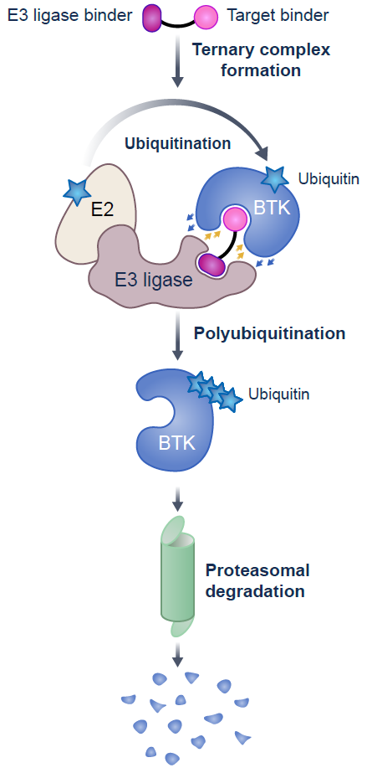
Background Novel BTK degrader NX-5948 addresses current unmet need in CLL treatment
NX-5948
The current standard of care in CLL focuses on utilizing the inhibitors of two key signaling pathways – BTK and BCL2
Unmet need still exists in the CLL treatment landscape:
Covalent and non-covalent BTKi resistance mutations¹ are found in more than half of patients who progress on BTKi therapies²
Some mutations in BTK can maintain intact B-cell receptor signaling through a scaffolding function of BTK³
The number of BCL2i refractory and double (BTKi/BCL2i) refractory patients is growing⁴
Novel BTK degrader NX-5948 offers an additional treatment modality:
Can overcome treatment-emergent BTKi resistance mutations⁵ and disrupt BTK scaffolding^{3,5}
References
1. Noviski et al. 20th Biennial International Workshop on CLL Meeting, Boston, MA. October 6–9, 2023
2. Molica et al. 66th ASH Annual Meeting, December 7–10, 2024
3. Montoya et al. Science 2024;383
4. Hayama and Riches. Onco Targets 2024;17
5. Linton K, et al. Oral presentation at European Hematology Association Hybrid Congress; 16 June 2024
BCL2, B-cell lymphoma 2; BCL2i, BCL2 inhibitor; BTK, Bruton’s tyrosine kinase; BTKi, BTK inhibitor; CLL, chronic lymphocytic leukemia
Shah, et al., ASH 2024, Abstract #884

Slide 90
NX-5948-301 (Bexobrutideg): Safety Profile TEAEs in ≥10% of overall population or Grade ≥3 TEAEs or SAEs in >1 patient
TEAEs, n (%) | Patients with CLL/SLL (n=60) |  |  | Overall population (N=125)
 | Any grade | Grade ≥3 | SAEs | Any grade | Grade ≥3 | SAEs
Purpura/contusionª | 22 (36.7) | – | – | 42 (33.6) | – | –
Fatigue^{b} | 16 (26.7) | – | – | 29 (23.2) | 2 (1.6) | –
Petechiae | 16 (26.7) | – | – | 28 (22.4) | – | –
Thrombocytopenia^{c} | 10 (16.7) | 1 (1.7) | – | 26 (20.8) | 7 (5.6) | –
Rash^{d} | 14 (23.3) | 1 (1.7) | 1 (1.7) | 24 (19.2) | 2 (1.6) | 1 (0.8)
Neutropenia^{e} | 14 (23.3) | 11 (18.3) | – | 23 (18.4) | 18 (14.4) | –
Anemia | 11 (18.3) | 4 (6.7) | – | 21 (16.8) | 10 (8.0) | –
Headache | 10 (16.7) | – | – | 21 (16.8) | 1 (0.8) | 1 (0.8)
COVID-19^{f} | 10 (16.7) | – | – | 19 (15.2) | 2 (1.6) | 2 (1.6)
Diarrhea | 12 (20.0) | 1 (1.7) | – | 18 (14.4) | 1 (0.8) | –
Cough | 9 (15.0) | – | – | 16 (12.8) | 1 (0.8) | –
Pneumonia^{g} | 4 (6.7) | 2 (3.3) | 2 (3.3) | 10 (8.0) | 6 (4.8) | 6 (4.8)
Lower respiratory tract infection | 3 (5.0) | 1 (1.7) | 1 (1.7) | 9 (7.2) | 3 (2.4) | 2 (1.6)
Fall | 1 (1.7) | 1 (1.7) | 1 (1.7) | 8 (6.4) | 2 (1.6) | 2 (1.6)
Hypertension | 2 (3.3) | 1 (1.7) | – | 7 (5.6) | 5 (4.0) | –
Hyponatremia | – | – | – | 3 (2.4) | 2 (1.6) | –
Pulmonary embolism | 1 (1.7) | 1 (1.7) | 1 (1.7) | 2 (1.6) | 2 (1.6) | 2 (1.6)
Subdural hematoma | 1 (1.7) | – | 1 (1.7) | 2 (1.6) | 1 (0.8) | 2 (1.6)
Tolerable safety profile consistent with prior disclosures
1 case of Grade 1 AFib in a CLL patient with pre-existing AFib
6 TEAEs resulted in drug discontinuation (1 CLL; 5 NHL)
2 Grade 5 AEs (1 pulmonary embolism; 1 case pending) deemed not related to NX-5948
ªPurpura/contusion includes episodes of contusion or purpura; ^{b}Fatigue was transient; ^{c}Aggregate of ‘thrombocytopenia’ and ‘platelet count decreased’; ^{d}Aggregate of ‘rash’ and ‘rash maculopapular’ and ‘rash pustular’; ^{e}Aggregate of 'neutrophil count decreased' or 'neutropenia’; ^{f}Aggregate of 'COVID-19' and 'COVID-19 pneumonia’; ^{g}Aggregate of 'pneumonia’ and ‘pneumonia klebsiella'
AE, adverse event; AFib, atrial fibrillation; CLL, chronic lymphocytic leukemia; NHL, non-Hodgkin’s lymphoma; SAE, serious adverse event; SLL, small lymphocytic lymphoma; TEAE, treatment emergent AE
Shah, et al., ASH 2024, Abstract #884

Slide 91
NX-5948-301 (Bexobrutideg): Overall Response Assessment Response rate deepens with longer time on treatment
CLL response-evaluable patients | Primary ORR analysis^{b} ≥1 response assessment(s) at 8 weeks (n=49)^{c} | Exploratory ORR analysis^{b} ≥2 response assessments at 16 weeks (n=38)^{c}
Objective response rate (ORR),ª % (95% CI) | 75.5 (61.1–86.7) | 84.2 (68.7–94.0)
Best response, n (%)
CR | 0 (0.0) | 0 (0.0)
PR | 36 (73.5) | 32 (84.2)
PR-L | 1 (2.0) | 0 (0.0)
SD | 10 (20.4) | 4 (10.5)
PD | 2 (4.1) | 2 (5.3)
ªObjective response rate includes CR + PR + PR-L
^{b}Patients who progressed prior to their first response assessment and patients who discontinued for any reason after their first response assessment are included in the denominators
^{c}Patients without identified target lesion(s) at baseline are evaluated as disease-evaluable per iwCLL criteria, while they may not be represented in waterfall plot
CLL, chronic lymphocytic leukemia; CR, complete response; iwCLL, International Workshop on CLL; ORR, objective response rate; PD, progressive disease; PR, partial response; PR-L, partial response with rebound lymphocytosis; SD, stable disease
Shah, et al., ASH 2024, Abstract #884

Slide 92
BGB-16673: Overall Response Rate Significant Responses, Particularly at 200 mg Dose Level
CaDAnCe-101: R/R CLL/SLL
 | 50 mg (n=1) | 100 mg (n=5) | 200 mg (n=16) | 350 mg (n=15) | 500 mg (n=12) | Totalª (N=49)
Best overall response, n (%)
CR/CRi | 0 | 1 (20.0) | 1 (6.3) | 0 | 0 | 2 (4.1)
PR^{b} | 1 (100) | 3 (60.0) | 12 (75.0) | 10 (66.7) | 7 (58.3) | 33 (67.3)
PR-L | 0 | 0 | 2 (12.5) | 0 | 1 (8.3) | 3 (6.1)
SD | 0 | 1 (20.0) | 0 | 1 (6.7) | 4 (33.3) | 6 (12.2)
PD | 0 | 0 | 1 (6.3) | 1 (6.7) | 0 | 2 (4.1)
Discontinued prior to first assessment | 0 | 0 | 0 | 3 (20.0) | 0 | 3 (6.1)
ORR, n (%)^{c} | 1 (100) | 4 (80.0) | 15 (93.8) | 10 (66.7) | 8 (66.7) | 38 (77.6)
Disease control rate, n (%)^{d} | 1 (100) | 5 (100) | 15 (93.8) | 11 (73.3) | 12 (100) | 44 (89.8)
Time to first response, median (range), months^{e} | 2.9 (2.9-2.9) | 4.2 (2.8-6.2) | 2.9 (2.6-8.3) | 2.8 (2.6-8.3) | 2.8 (2.6-8.3) | 2.8 (2.6-8.3)
Time to best response, median (range), months | 2.9 (2.9-2.9) | 5.6 (2.8-11.1) | 3.4 (2.6-13.8) | 5.6 (2.6-8.3) | 4.2 (2.6-8.6) | 3.6 (2.6-13.8)
Duration of exposure, median (range), months | 26.4 (26.4-26.4) | 13.8 (13.6-18.6) | 10.6 (2.9-18.9) | 10.3 (0.2-16.8) | 9.3 (6.8-15.4) | 10.4 (0.2-26.4)
Thompson et al. BGB-16673-101 ASH 2024​

Slide 93
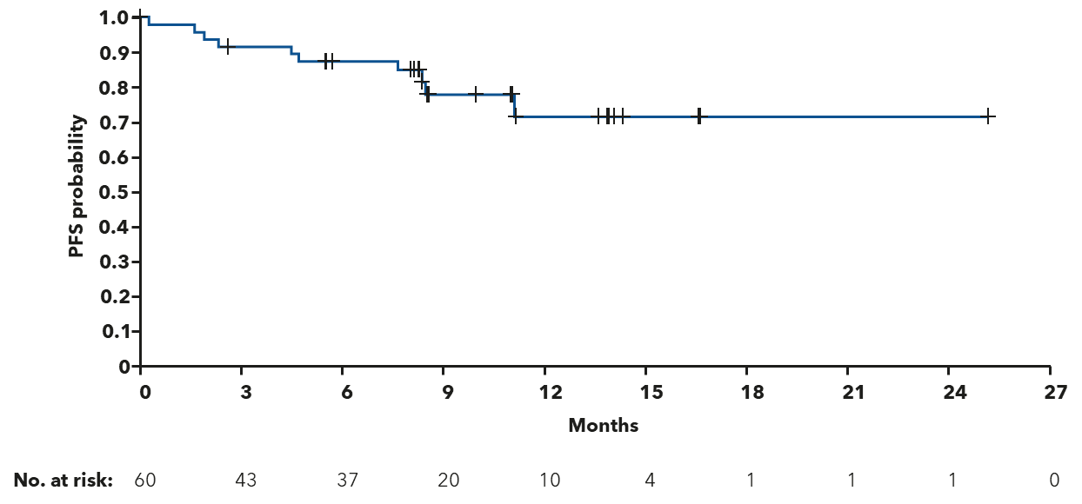
BGB-16673: Progression-Free Survival
CaDAnCe-101: R/R CLL/SLL
Thompson et al. BGB-16673-101 ASH 2024​

Slide 94
Conclusions
Treatment for relapsed disease directed by prior treatment, duration of last remission, and clinical resistance to targeted agent(s)
Refractory disease remains unmet need – promising agents in development
Alternative targeted therapies
CD19-CAR T-cells
Bispecific antibodies

Slide 95
Agenda
Module 1: Selection and Sequencing of Therapy for Relapsed/Refractory (RR) Chronic Lymphocytic Leukemia (CLL) — Dr Wierda
Module 2: First-Line Therapy for CLL — Dr Coombs
Module 3: Novel Agents and Strategies for RR CLL — Dr Wierda
Module 4: ASCO and EHA 2025

Slide 96
SEQUOIA 5-year follow-up in arm C: Frontline zanubrutinib monotherapy in patients with del(17p) and treatment-naive chronic lymphocytic leukemia/small lymphocytic lymphoma (CLL/SLL).
Tam C et al.
ASCO 2025; Abstract 7011.
RAPID ORAL ABSTRACT SESSION | SATURDAY, MAY 31 | 8:12 AM CT

Slide 97
Combination of zanubrutinib (zanu) + venetoclax (ven) for treatment-naive (TN) CLL/SLL: Results in SEQUOIA arm D.
Shadman M et al.
ASCO 2025; Abstract 7009.
RAPID ORAL ABSTRACT SESSION | SATURDAY, MAY 31 | 8:00 AM CT

Slide 98
Impact of venetoclax-based therapies on autoimmune cytopenias in patients with chronic lymphocytic leukemia: Final analysis of a multicenter study conducted by ERIC. Vitale C et al. EHA 2025; Abstract S157 Updated efficacy and safety of the bruton tyrosine kinase (BTK) degrader BGB-16673 In patients (Pts) with relapsed or refractory (R/R) CLL/SLL: Results from the ongoing phase (Ph) 1 CADANCE-101 study. Scarfò L et al. EHA 2025; Abstract S158 Updated results from the phase 1 study of sonrotoclax (BGB-11417), a novel BCL2 inhibitor, in combination with zanubrutinib for relapsed/refractory CLL/SLL demonstrate deep and durable responses. Cheah CY et al. EHA 2025; Abstract S159
EHA 2025 | ORAL PRESENTATION SESSION | SUNDAY, JUNE 15

Slide 99
Data + Perspectives: Clinical Investigators Discuss the Current and Future Clinical Care of Patients with HER2-Positive Gastrointestinal Cancers
A CME Symposium Held in Conjunction with the 2025 ASCO® Annual Meeting
Sunday, June 1, 2025 7:00 PM – 8:30 PM CT (8:00 PM – 9:30 PM ET)
Faculty
Haley Ellis, MD
Sara Lonardi, MD
Kanwal Raghav, MD, MBBS
Moderator
Christopher Lieu, MD

Slide 100
Cases from the Community: Investigators Discuss Available Research Guiding the Care of Patients with Ovarian and Endometrial Cancer
A CME Symposium Held in Conjunction with the 2025 ASCO® Annual Meeting
Sunday, June 1, 2025 7:00 PM – 9:00 PM CT (8:00 PM – 10:00 PM ET)
Faculty
Joyce F Liu, MD, MPH
David M O’Malley, MD
Ritu Salani, MD, MBA
Alessandro D Santin, MD
Moderator
Shannon N Westin, MD, MPH, FASCO, FACOG

Slide 101
Thank you for joining us! Please take a moment to complete the survey currently up on Zoom. Your feedback is very important to us. The survey will remain open for 5 minutes after the meeting ends. Information on how to obtain CME credit is provided in the Zoom chat room. Attendees will also receive an email in 1 to 3 business days with these instructions.

