Slide 1
Integrating New Advances into the Care of Patients with Cancer
A Multitumor Symposium in Partnership with the American Oncology Network
CME/MOC, NCPD and ACPE Accredited
Saturday, November 8, 2025
10:00 AM – 3:00 PM CT

Slide 2
Agenda
Module 1 — Lung Cancer: Drs Gainor, Langer and Shields
Module 2 — Chronic Lymphocytic Leukemia: Dr Rogers
Module 3 — Ovarian Cancer: Dr Konecny
Module 4 — Gastroesophageal Cancers: Dr Shah

Slide 3


Gastroesophageal Cancers Faculty
Manish A Shah, MD
Professor of Medicine
Bartlett Family Professor of Gastrointestinal Oncology
Chief, Solid Tumor Oncology
Weill Cornell Medicine/NewYork-Presbyterian Hospital
New York, New York
MODERATOR
Stephen "Fred" Divers, MD
Chief Medical Officer
American Oncology Network
Hot Springs, Arkansas

Slide 4
Dr Shah — Disclosures
No relevant conflicts of interest to disclose.

Slide 5
Dr Divers — Disclosures
Advisory Committees | Daiichi Sankyo Inc

Slide 6
Snapshot of AON Practice
Gastroesophageal Cancers

Slide 7
Snapshot of AON Practice
Gastroesophageal Cancers — Immunotherapy

Slide 8
Snapshot of AON Practice
Gastroesophageal Cancers — Chemotherapy

Slide 9
Snapshot of AON Practice
Gastroesophageal Cancers — HER2-Positive

Slide 10
Snapshot of AON Practice
Gastroesophageal Cancers – CLDN18.2-Positive

Slide 11

Highlights and Principals of Management of Metastatic Gastric/GEJ Adenocarcinoma
AON Annual Meeting
Dallas, Texas
November 8, 2025
Manish A. Shah, MD FASCO
Weill Cornell Medicine/ New York-Presbyterian
mas9313@med.cornell.edu

Slide 12
Biomarkers in Gastroesophageal Adenocarcinoma

Slide 13
Key Biomarkers in Gastroesophageal Cancer
Key markers in advanced disease
HER2 positive: 15%-20% of patients; improved survival with chemo + HER2-targeting trastuzumab
MSI high: 3%-5% of patients, high response rates to immunotherapies ± chemo
PD-L1 positive: 30%-50% of patients; identifies those more likely to benefit from immunotherapy; likely gradation within PD-L1+ (CPS)
CLDN18.2 high: 30%-35% of patients; response predictor for CLDN18.2-targeting agent
Investigational biomarkers
FGFR2 amp: 5%-10% of patients; multiple trials of inhibitors
FGFR2 high: May be up to 30% of HER2 negative
EGFR amp: 5%-7%; may predict response to EGFR agents
Tumor agnostic
Mismatch repair deficiency (or MSI-H)
Tumor mutation burden
NTRK fusion
AMP = amplification; CPS = combined positive score; EGFR = epidermal growth factor receptor; FGFR2 = fibroblast growth factor receptor 2; HER = human epidermal growth factor receptor
Kuwata T. Pathol Int. 2024 Jun;74(6):301-316.

Slide 14
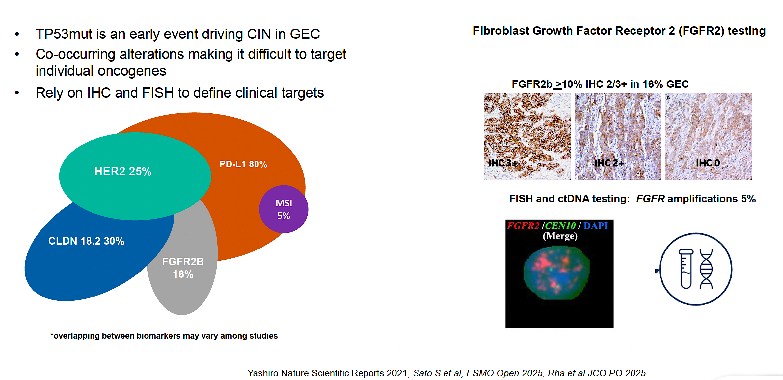
Biomarkers don’t neatly fit in a pie!

Slide 15
Immunotherapy in Gastroesophageal Adenocarcinoma

Slide 16
Overview of Select Trials of Immunotherapy in
Upper GI Cancers: Increasing Complexity
Parameter | CheckMate -649² | KEYNOTE-859³ | Rationale-05
Disease location | Gastric, GEJ, esophagus | Gastric, GEJ | Gastric, GEJ
Histology | Adenocarcinoma | Adenocarcinoma | Adenocarcinoma
Agent | Nivolumab + chemo vs chemo | Pembrolizumab + chemo vs chemo | Tislelizumab + chemotherapy vs chemo
Setting | 1L advanced | 1L advanced | 1L advanced
ORR, % | 60 vs 45 (CPS ≥5) | 51.3 vs 42 | 50 vs 43 (TAP >5)
PFS HR | 0.68 (CPS ≥5) | 0.76 | 0.67 (TAP >5)
OS ∆, mo | 3.3 (CPS ≥5), 2.7 (CPS ≥1), 2.2 (all patients) | 1.4 | 4.6 mo (TAP >5)

Slide 17
CheckMate-649 Global Phase 3 Trial:
Nivolumab Plus Chemotherapy Improved Survival^{1,2}
FDA-approved April 2021
PD-L1 CPS ≥5
 | Nivo + Chemo (n = 473) | Chemo (n = 482)
Median OS, mo | 14.4 | 11.1
(95% CI) | (13.1-16.2) | (10.0-12.1)
HR (98.4% CI) | 0.71 (0.59-0.86)
P | < .0001
All randomized
 | Nivo + Chemo (n = 789) | Chemo (n = 792)
Median OS, mo | 13.8 | 11.6
(95% CI) | (12.6-14.6) | (10.9-12.5)
HR (99.3% CI) | 0.80 (0.68-0.94)
P | .0002
100
100
12-mo
12-mo
rate
rate
80
80
60
57%
60
55%
OS, %
OS, %
40
40
Nivo + chemo
48%
20
46%
20
Nivo + chemo
Chemo
0
Chemo
0
0
3
6
9
12
15
18
21
24
27
30
33
36
39
0
3
6
9
12
15
18
21
24
27
30
33
36
39
Time, mo
Time, mo
No. at risk
Nivo + chemo
473
438
377
313
261
198
149
96
65
33
22
9
1
0
789
731
621
506
420
308
226
147
100
49
34
14
2
0
Chemo
482
421
350
271
211
138
98
56
34
19
8
2
0
0
792
697
586
469
359
239
160
94
59
35
15
7
2
0
Grade 3-4 TRAEs were reported in 59% of patients in the nivolumab + chemo arm and 44% of patients in the chemo arm
Treatment-related deaths occurred in 16 (2%) and 4 (1%) of patients in the nivolumab + chemo and chemo arms, respectively

Slide 18
KEYNOTE-859: 1L Pembrolizumab + Chemotherapy Improves Survival for Advanced G/GEJ Cancer¹
ITT Population OS
ITT Population PFS
 | Pembro + Chemo | Placebo + Chemo
Patients with event, % | 76.3 | 84.4
Median OS, mo (95% CI) | 12.9 (11.9-14.0) | 11.5 (10.6-12.1)
HR (95% CI) | 0.78 (0.70-0.87); P < .0001
I
 | Pembro + Chemo | Placebo + Chemo
Patients with event, % | 72.4 | 77.1
Median PFS, mo (95% CI) | 6.9 (6.3-7.2) | 5.6 (5.5-5.7)
HR (95% CI) | 0.76 (0.67-0.85); P < .0001
I
I
I
I
I
I
I
I
I
I
I
I
I
I
12-mo rate:
28.9
19.3
I
I
I
I
I
12-mo rate:
52.7
46.7
I
I
PFS, %
I
OS, %
I
24-mo rate:
28.2
18.9
I
24-mo rate:
17.8
9.4
I
I
I
I
I
I
I
I
I
I
I
I
I
I
I
I
I
I
I
I
I
I
I
I
I
I
I
I
I
I
I
I
I
I
I
I
I
I
I
I
I
I
I
I
I
I
I
I
I
I
Pembro + chemo
I
I
I
I
I
I
I
I
I
I
I
I
I
I
I
I
I
I
I
I
I
I
Pembro + chemo
I
I
I
I
I
I
I
I
I
I
I
I
I
I
I
I
I
I
I
I
I
I
I
I
I
I
I
I
I
I
I
I
I
I
I
I
I
I
I
I
I
I
I
I
I
I
I
I
I
I
I
I
I
I
I
I
I
I
I
I
I
I
I
I
I
I
I
I
I
I
I
I
I
I
I
I
I
I
I
I
I
I
I
I
I
I
I
I
I
I
I
I
I
I
I
I
I
I
I
I
I
I
I
I
I
I
I
I
I
I
Placebo + chemo
I
I
I
Placebo + chemo
I
I
I
I
I
I
I
I
I
I
I
I
I
I
I
I
I
I
I
I
I
I
I
I
I
I
I
I
I
I
I
I
I
I
I
I
I
I
I
I
I
I
I
I
I
I
I
I
I
I
I
I
I
I
I
I
I
I
I
I
I
I
I
Time, mo
Time, mo
No. at Risk
Pembro + chemo | 790 | 663 | 490 | 343 | 240 | 143 | 95 | 55 | 19 | 3 | 0
Placebo + chemo | 789 | 636 | 434 | 274 | 169 | 95 | 58 | 26 | 10 | 0 | 0
No. at Risk
Pembro + chemo | 790 | 461 | 199 | 131 | 94 | 63 | 36 | 22 | 9 | 1 | 0
Placebo + chemo | 789 | 407 | 130 | 71 | 41 | 19 | 11 | 3 | 1 | 0 | 0
In addition to higher ORR (51.3% vs 42.0%), responses were also more durable in pembrolizumab arm (median DOR, 8.0 vs 5.7 months)

Slide 19
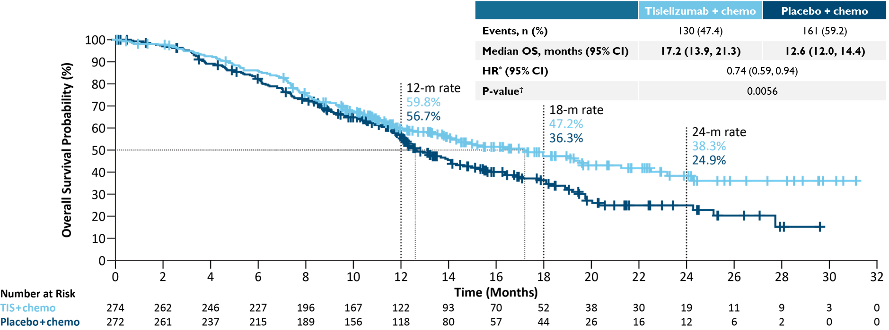
RATIONALE-305: Interim Analysis
Tislelizumab plus chemotherapy demonstrated statistically significant improvement in OS vs placebo plus chemotherapy
Data cutoff: October 08, 2021.
*Primary OS analysis: Stratified by regions (east Asia vs rest of the world) and presence of peritoneal metastasis. ​†One-sided stratified log-rank test. 116 (42.3%) patients and 147 (54.0%) patients in tislelizumab plus chemotherapy arm and placebo plus chemotherapy arm received subsequent anticancer systemic therapies, respectively. Of those, 19 (6.9%) patients and 38 (14.0%) patients received immunotherapy.
CI=confidence interval, HR=hazard ratio, OS=overall survival, m=month
Moehler M et al. ASCO-GI 2023 abstract no. 286 Jan19-21, 2023

Slide 20
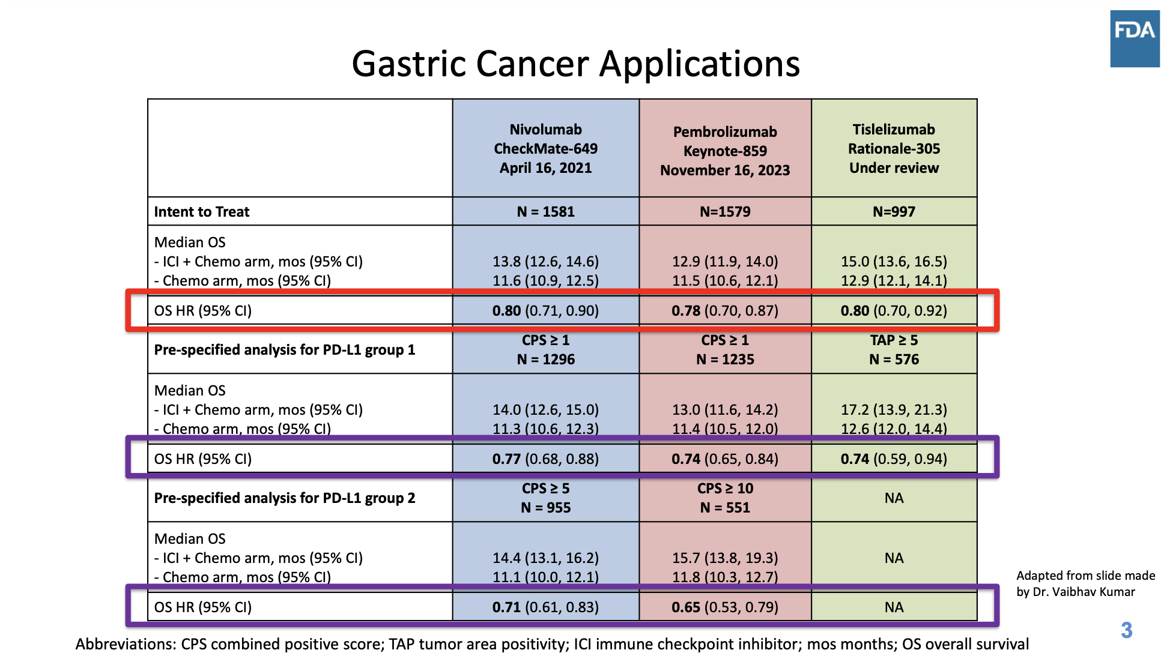
FFDA ODAC Meeting – September 24, 2024

Slide 21
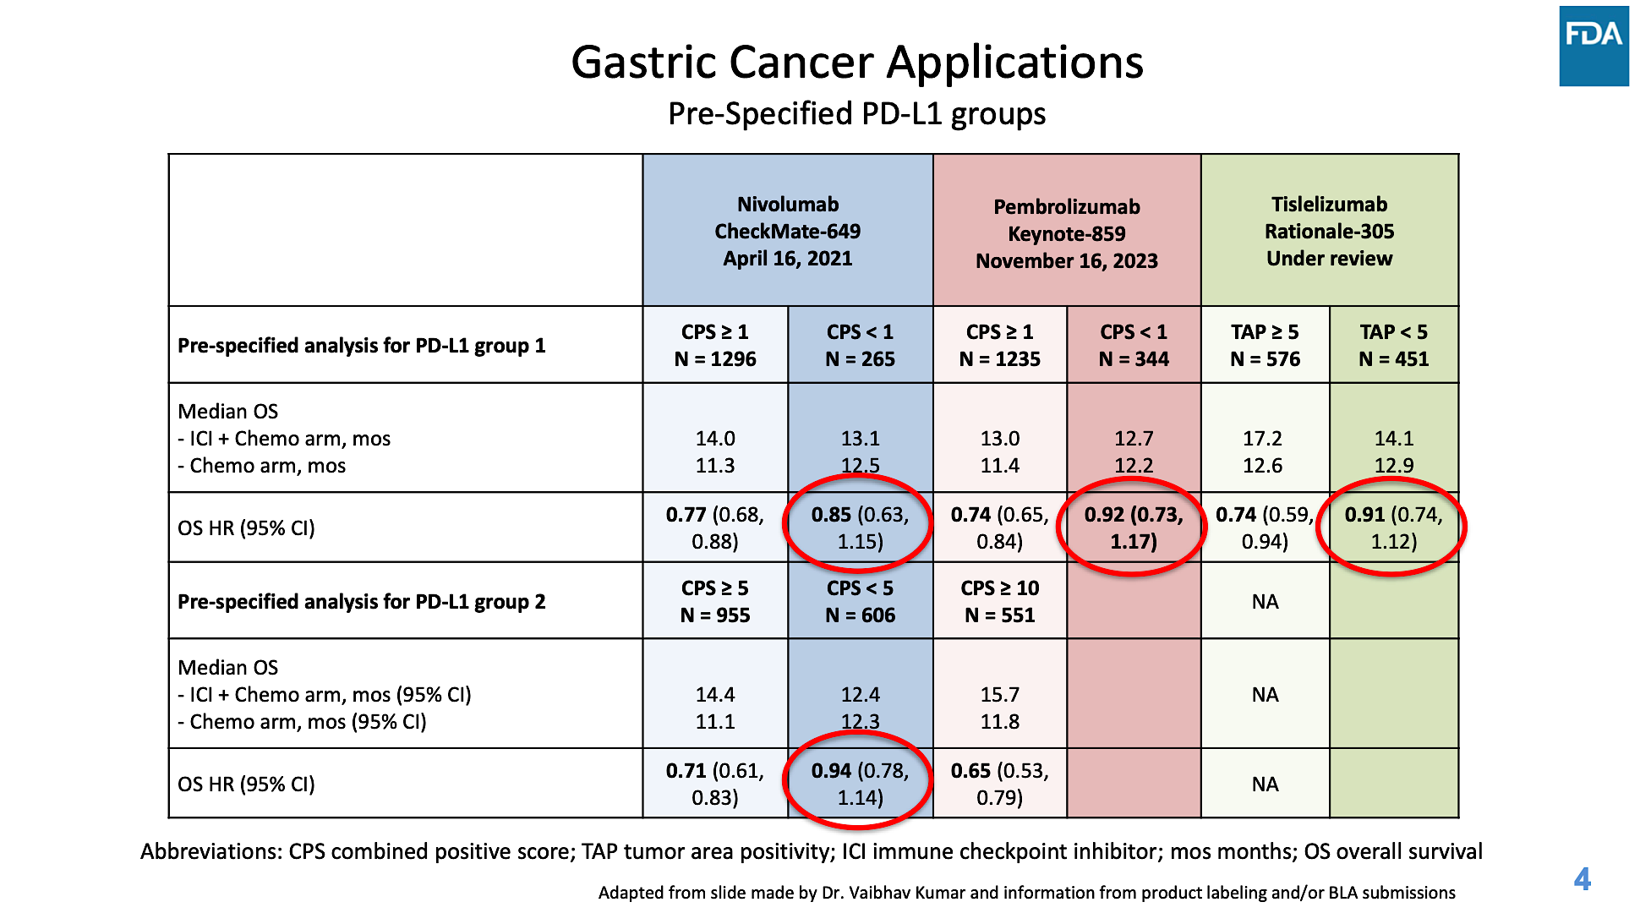

Slide 22
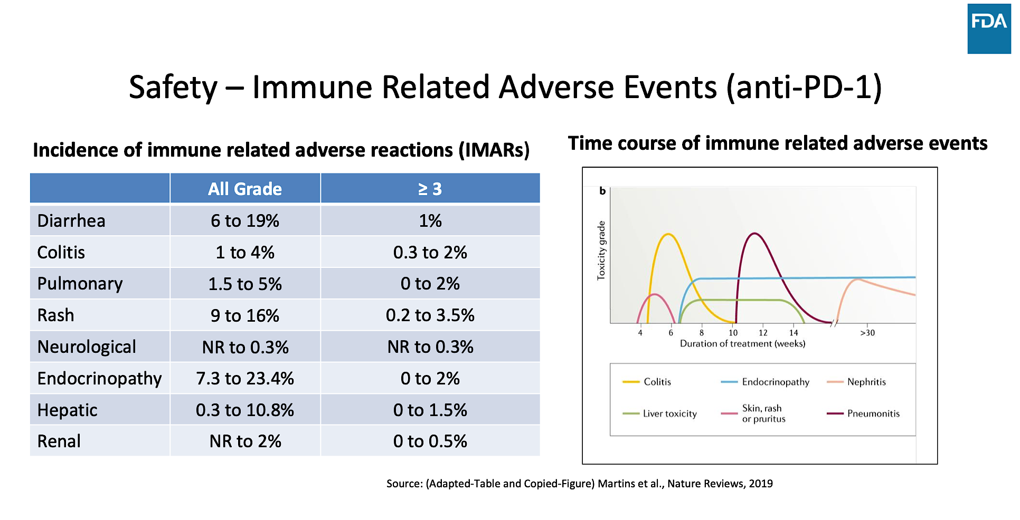

Slide 23
Targeting HER2 in Gastroesophageal Junction Adenocarcinoma

Slide 24
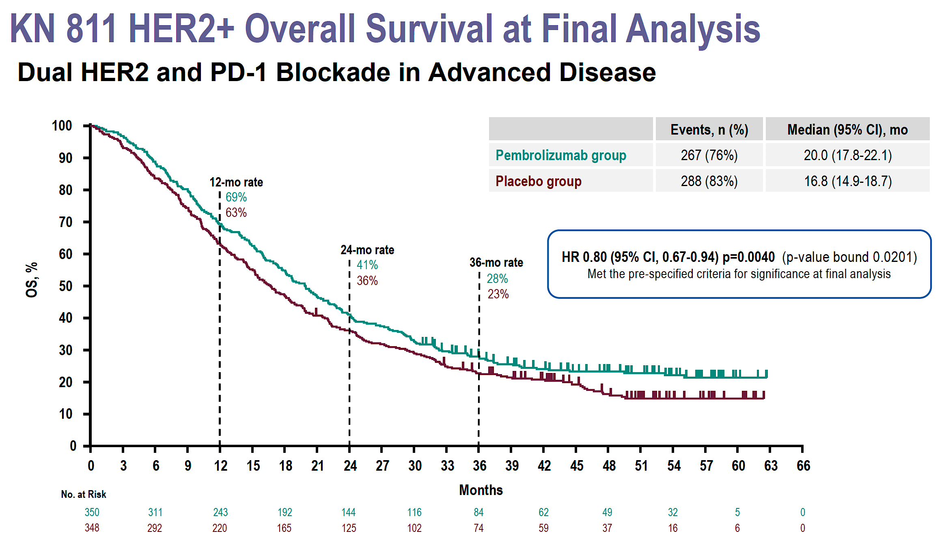
Janjigian YY et al. ESMO 2024. Abstract 1400O

Slide 25
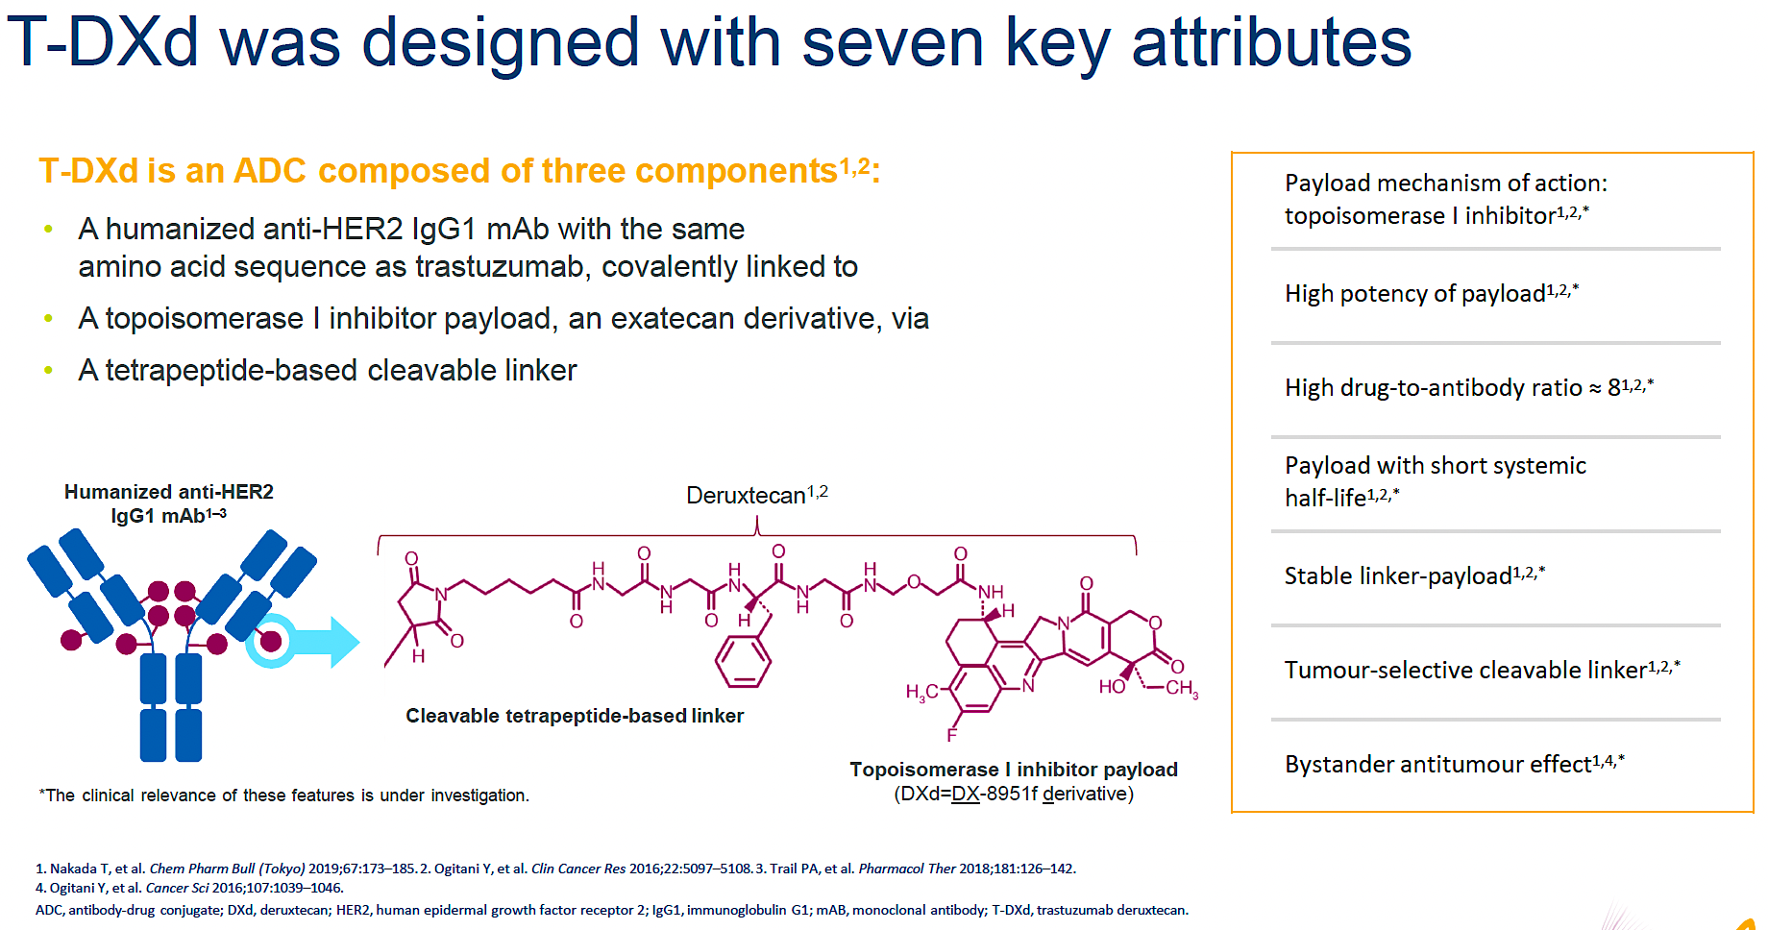

Slide 26
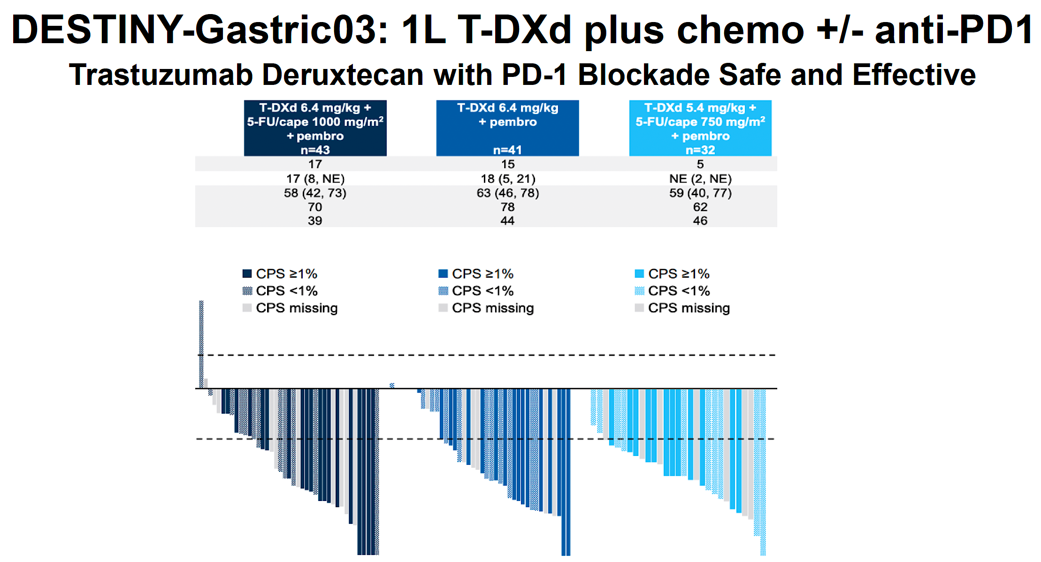

Slide 27
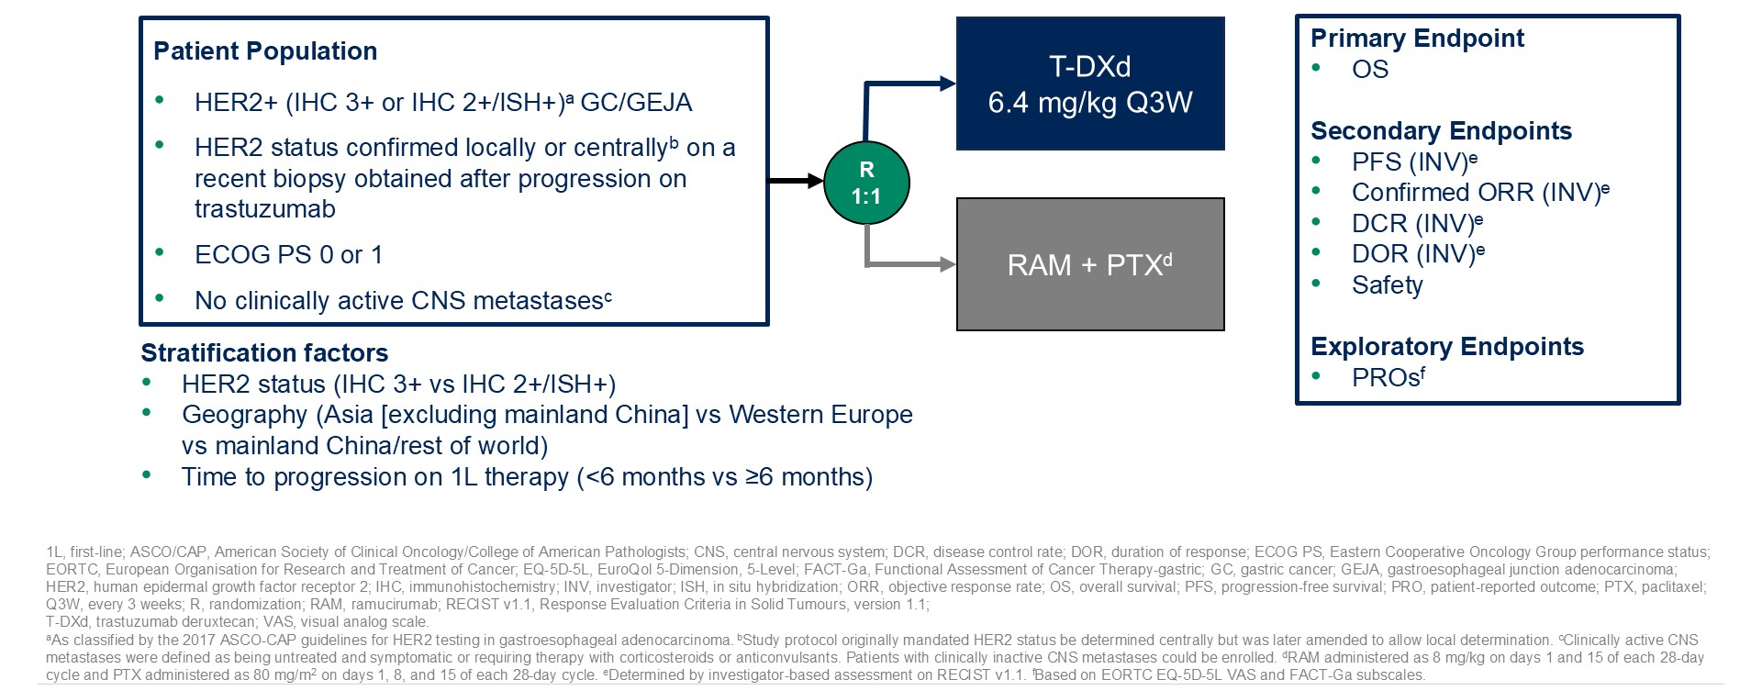
Phase III DESTINY-Gastric04 Study Design
Shitara K et al. ASCO 2025;Abstract LBA4002.
Shitara K et al. ASCO 2025;Abstract LBA4002.

Slide 28
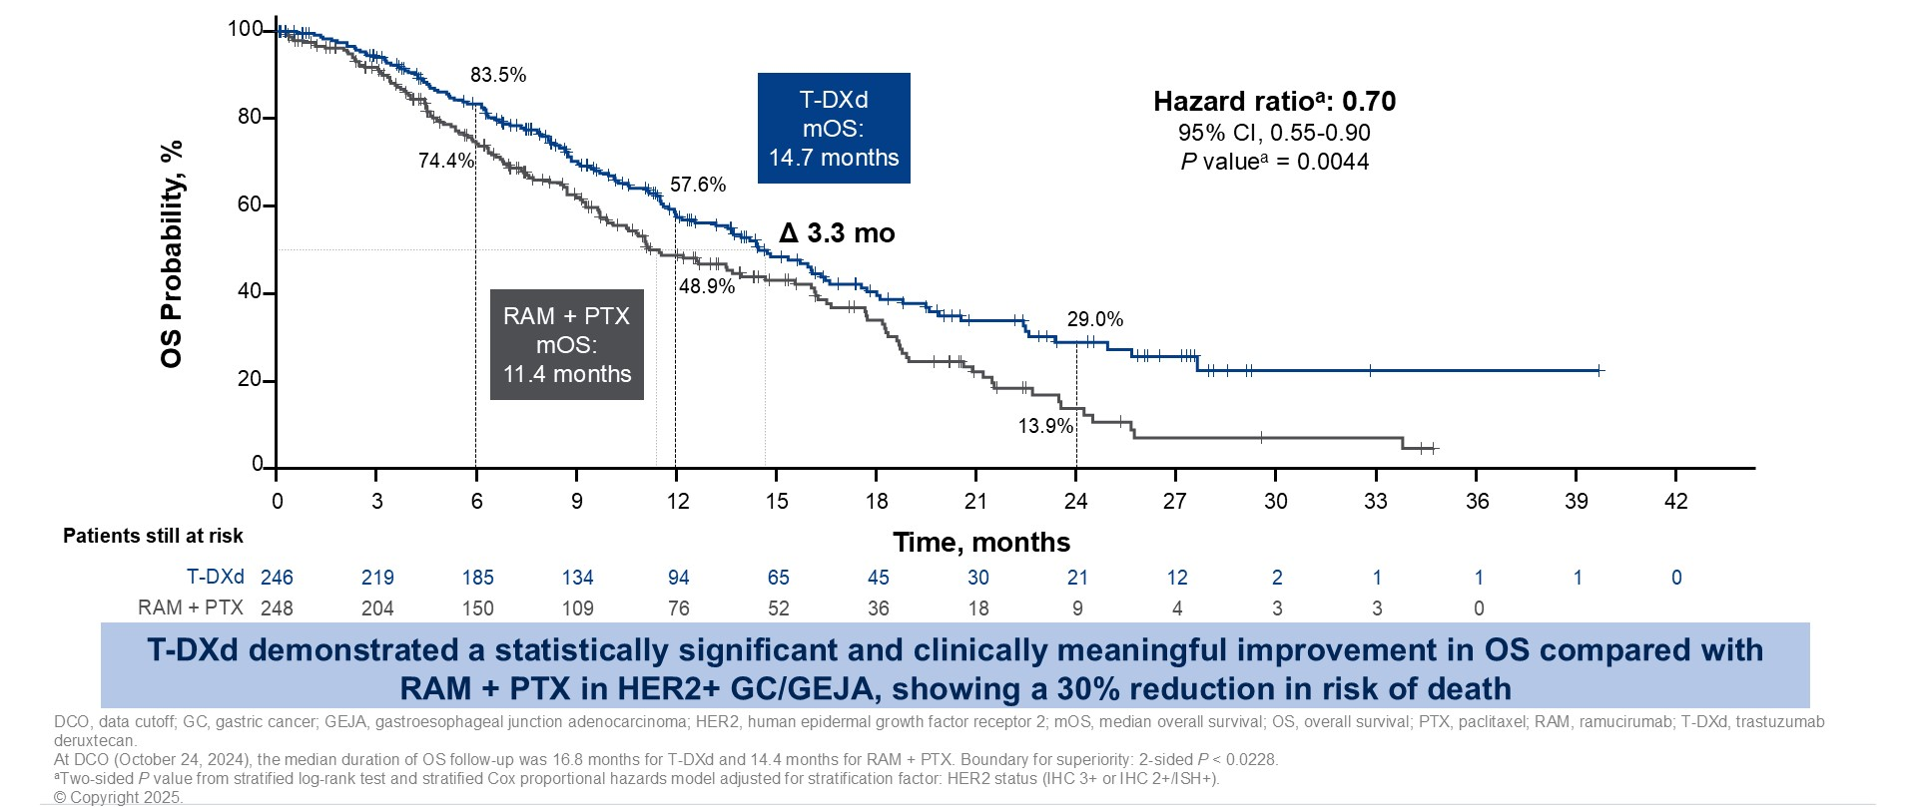
Phase III DESTINY-Gastric04: OS (Primary Endpoint)
Shitara K et al. ASCO 2025;Abstract LBA4002.
Shitara K et al. ASCO 2025;Abstract LBA4002.

Slide 29
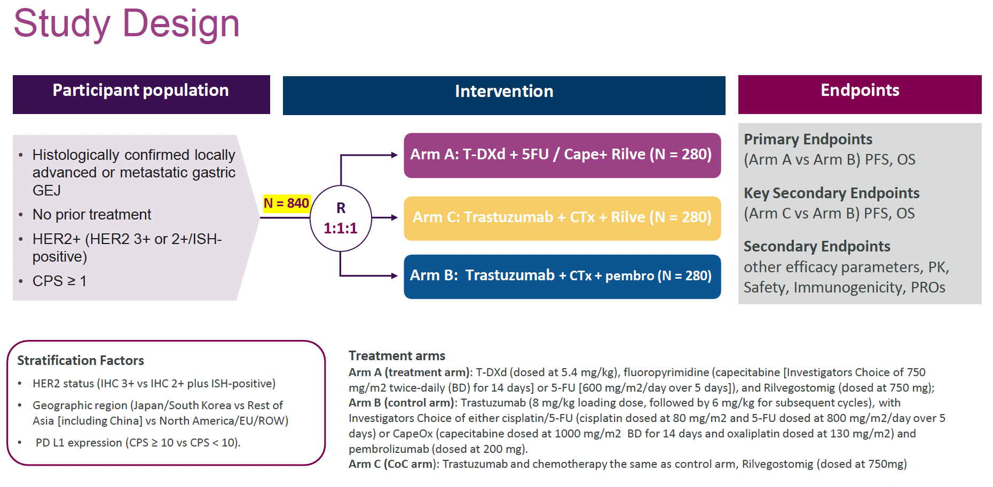
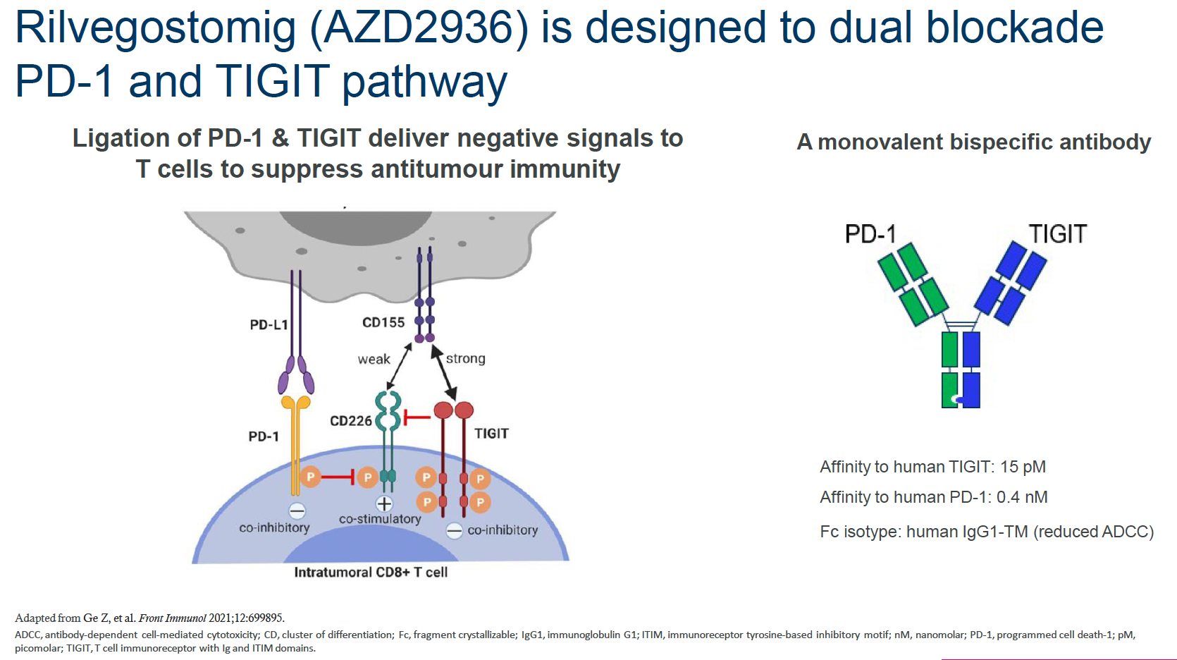
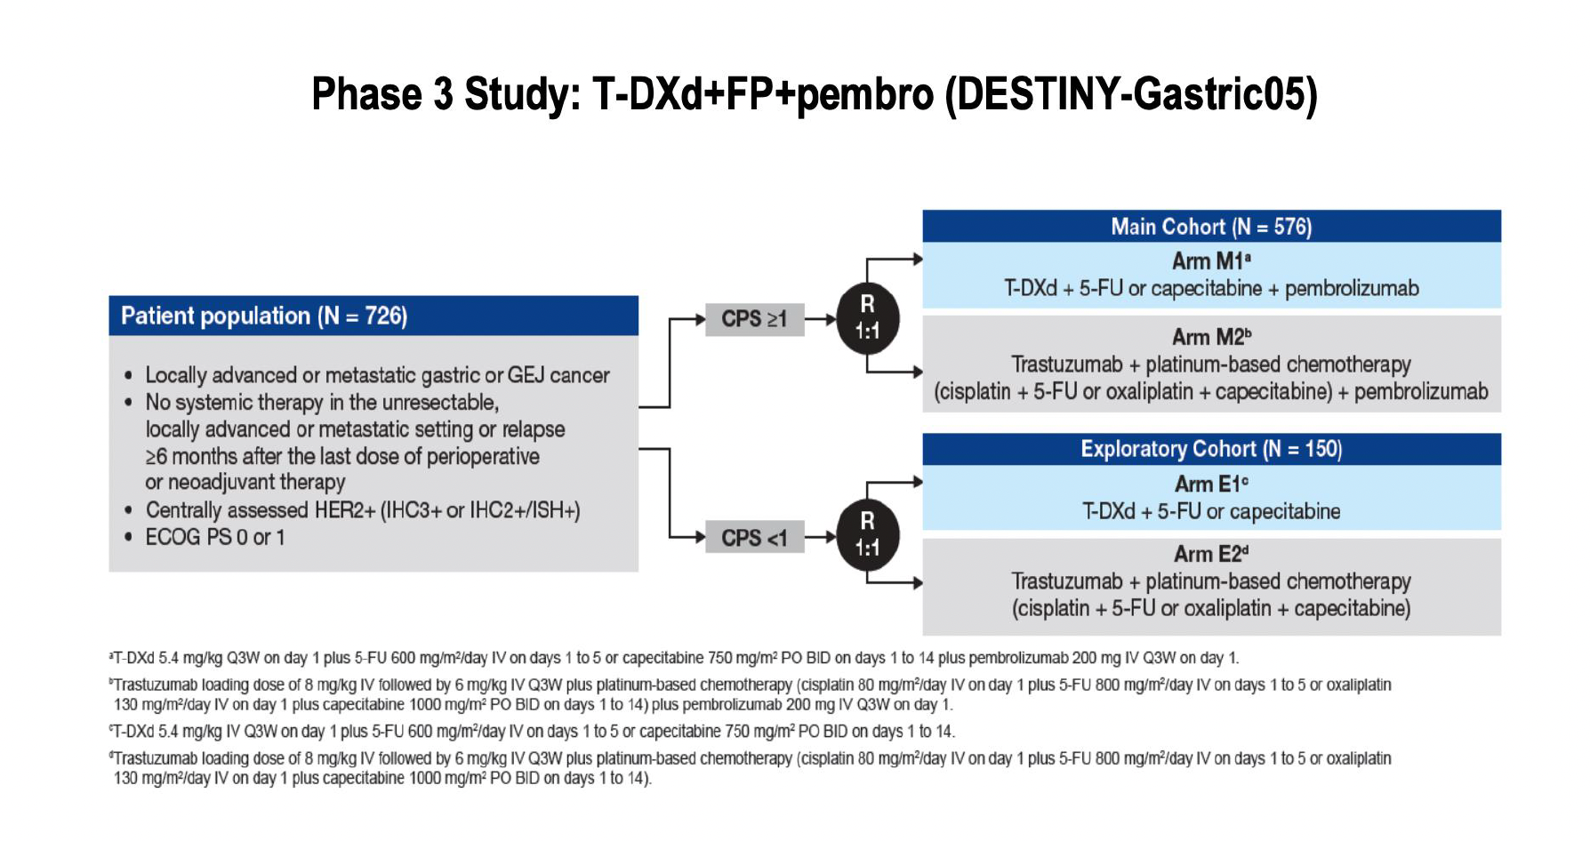
ARTEMIDE-Gastric 01 Study
delivers negative signals to

Slide 30
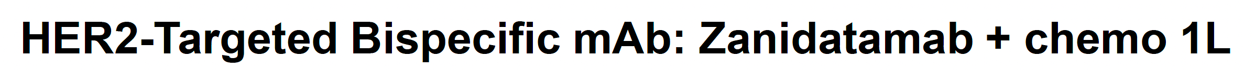
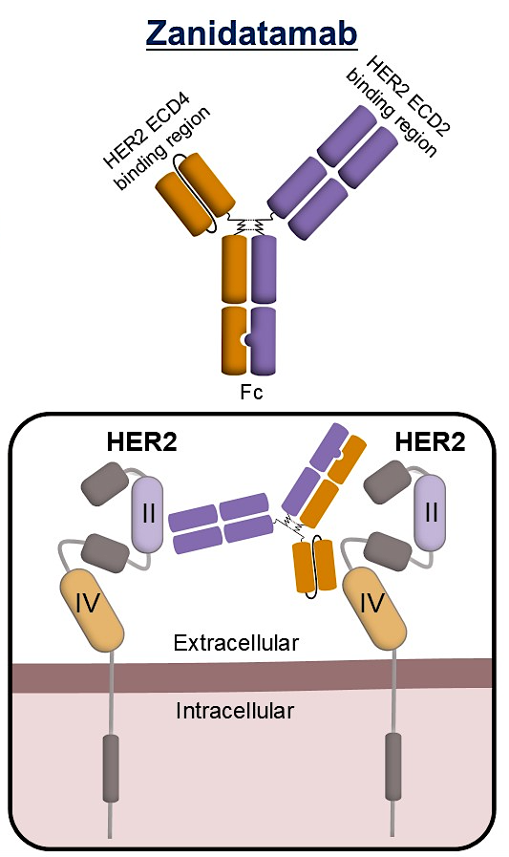
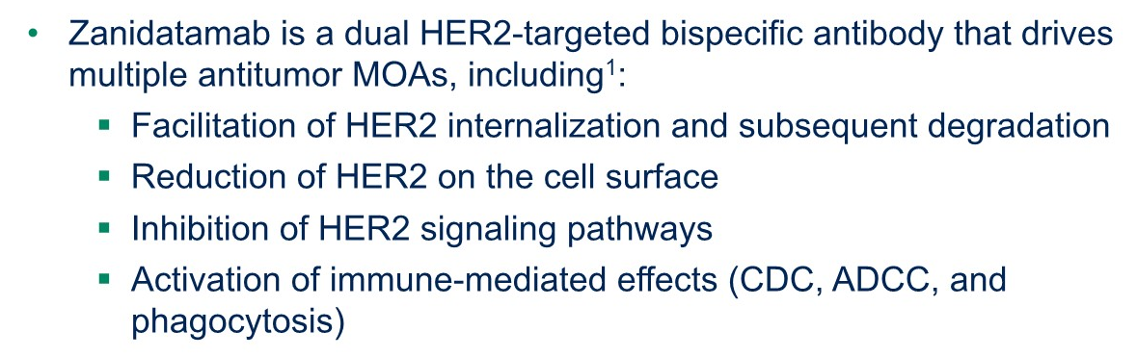
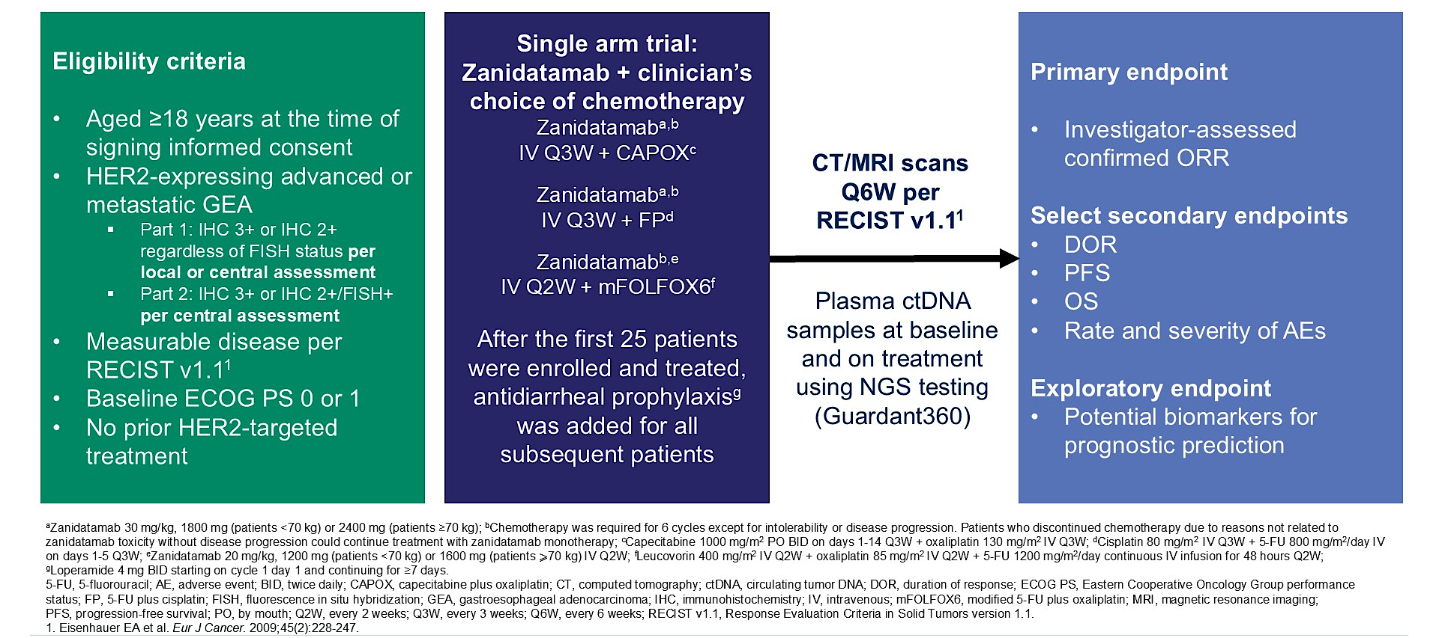
Elimova E et al. ASCO 2025;Abstract 4013

Slide 31
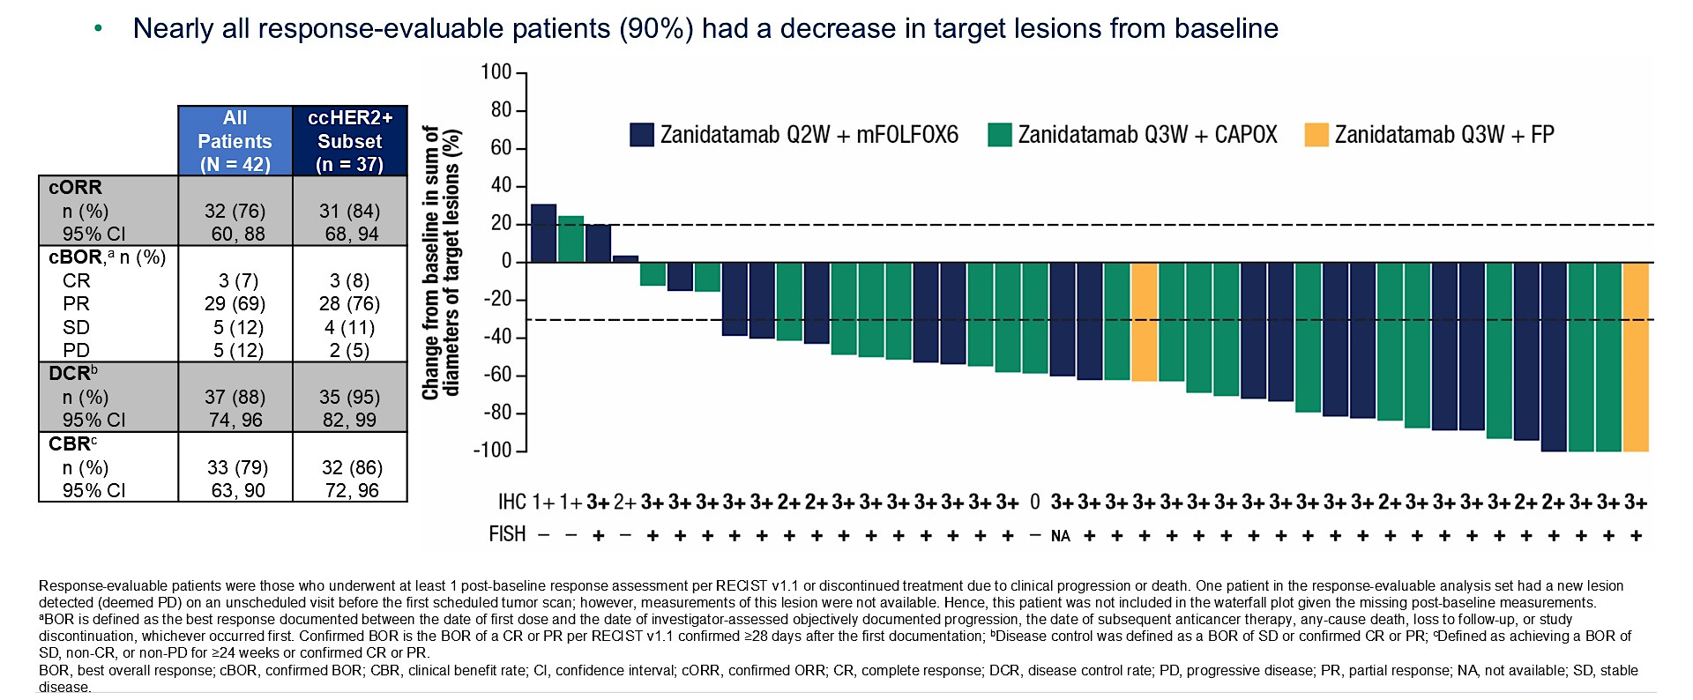
HERIZON-GEA-01: Antitumor Activity
Elimova E et al. ASCO 2025;Abstract 4013

Slide 32
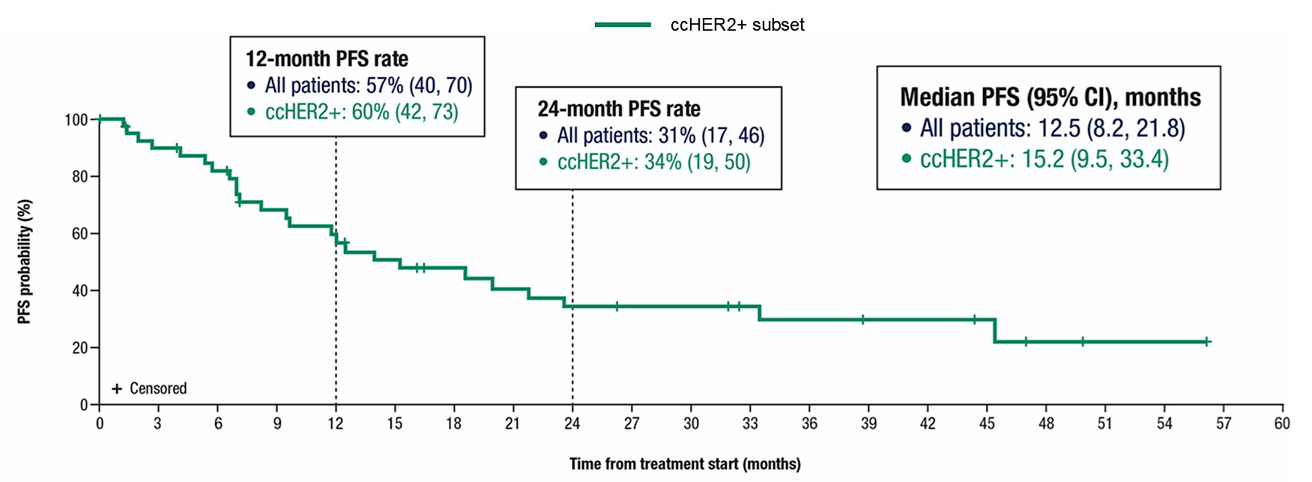
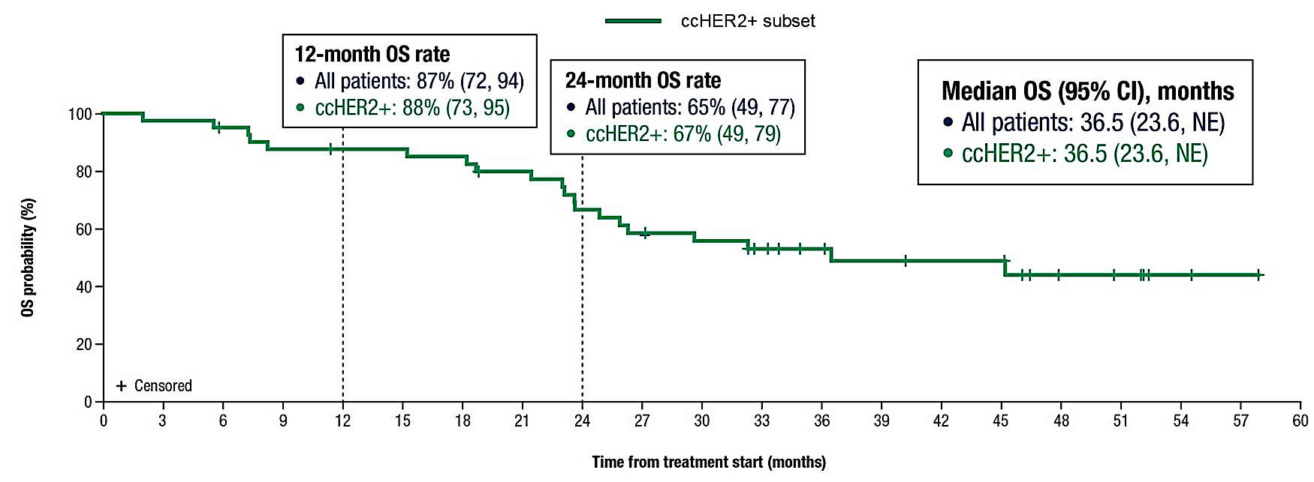
HERIZON-GEA-01: Survival
PFS
OS
Elimova E et al. ASCO 2025;Abstract 4013

Slide 33
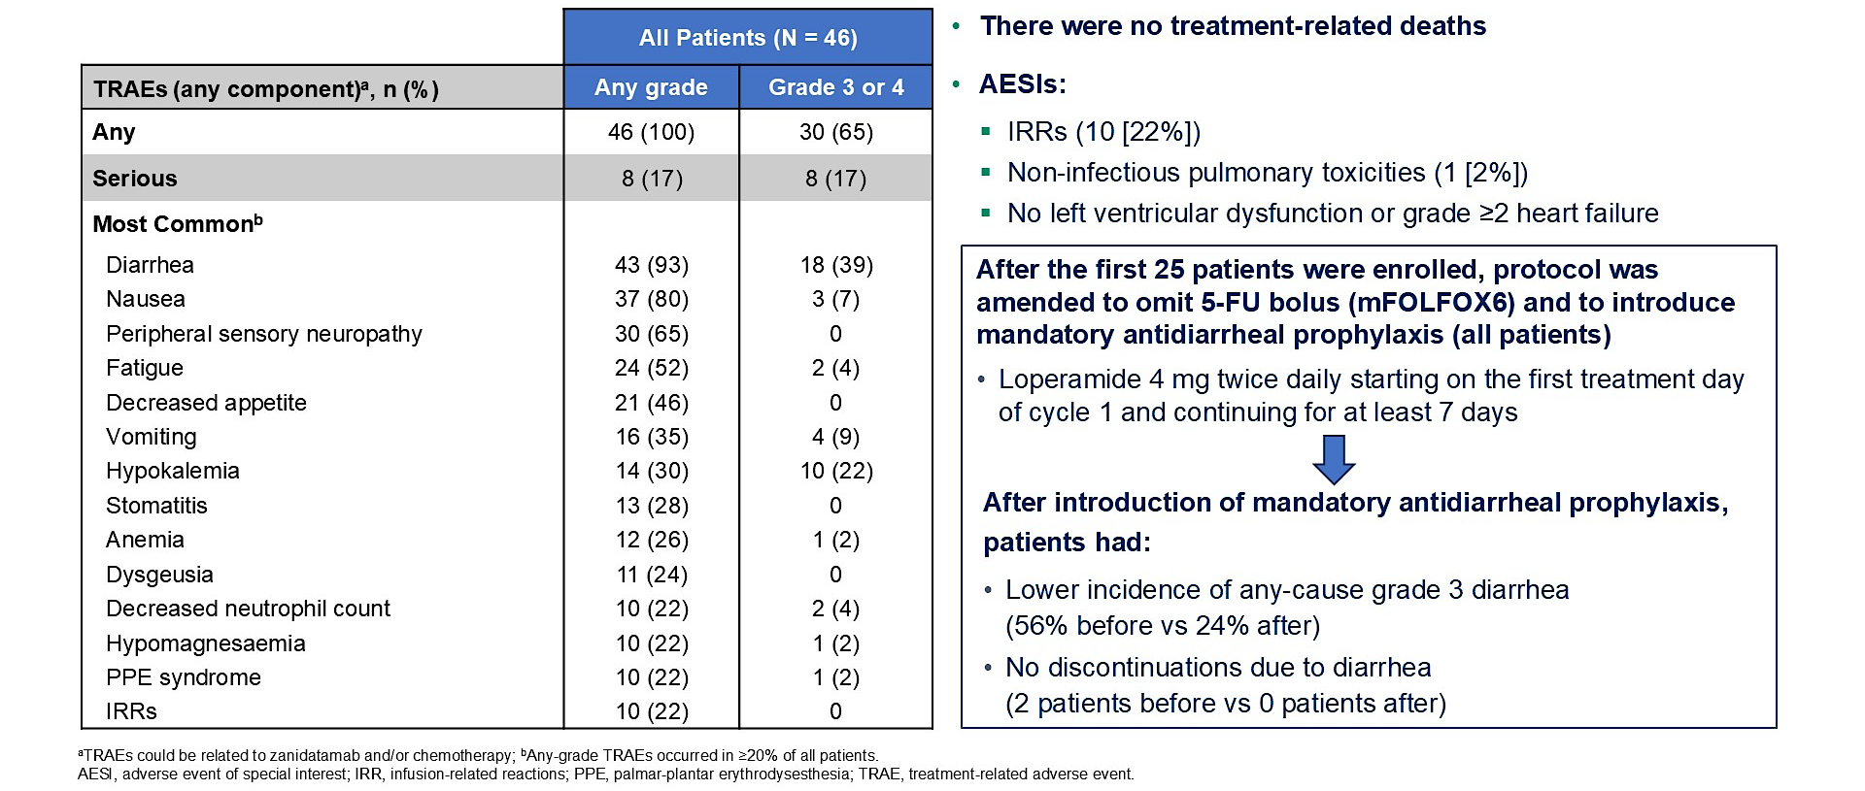
HERIZON-GEA-01: Safety Outcomes
Elimova E et al. ASCO 2025;Abstract 4013

Slide 34
Targeting Claudin18.2 in Gastroesophageal Adenocarcinoma

Slide 35
Claudin18.2: Leveraging Biology
Normal Gastric Epithelia
Gastric Cancer
Luminal
Luminal
Malignant
Transformation
Claudin18.2 is a major structural component of intercellular tight junctions
Not routinely expressed in any normal tissue outside gastric mucosa (cancer-restricted antigen)
Broadly expressed in several tumor types including gastric, GEJ, biliary, and pancreatic
Baek. Anticancer Res. 2019;39:6973.

Slide 36
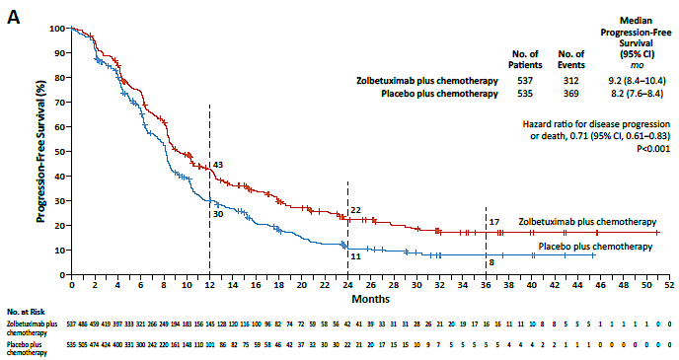
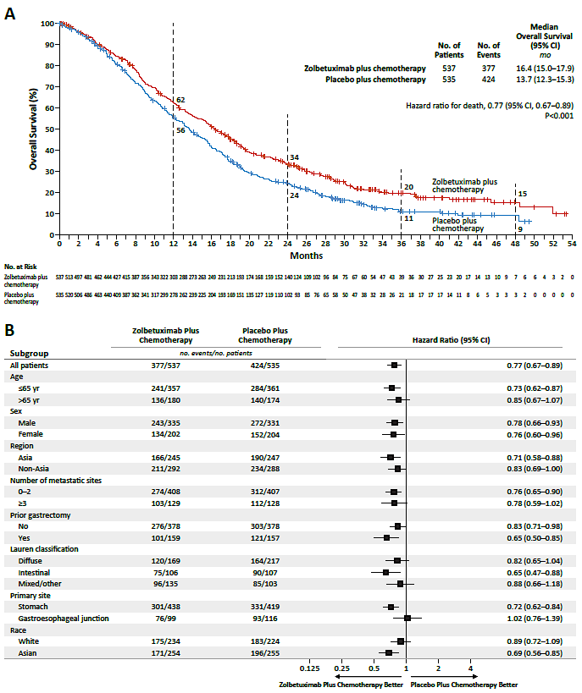
SPOTLIGHT and GLOW – Combined Final Analysis
Progression Free Survival
Overall Survival
Total Population – 1072 (n=537 Zolbe + chemo)
PFS HR 0.71 (0.61-0.83), p < 0.001
OS HR 0.77 (0.67-0.89), p < 0.01
Measurable disease (n=820),
Complete Response - 5.2%. v. 3.1%
Partial Response - 52.2%. v. 52.2%
Overall Response Rate - 57.4%. Vs. 55.3%
Key Toxicity
> Grade 3 toxicity higher than control
Nausea - 12.6%. vs. 4.7%
Vomiting 14.3%. vs. 4.9%
Decreased appetite - 6.4% vs. 2.5%
Shitara K, Shah MA NEJM Letter 2024

Slide 37
SPOTLIGHT and GLOW – Combined Final Analysis
Key Points
Broad activity
? GEJ resistance?
? White people?
Validated Target
Shitara K, Shah MA NEJM Letter 2024

Slide 38
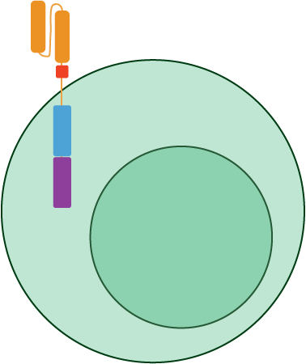
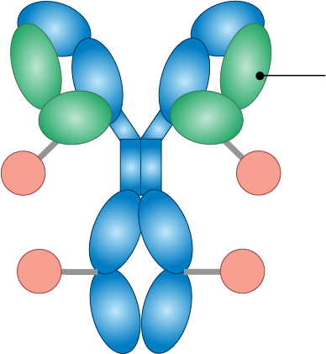

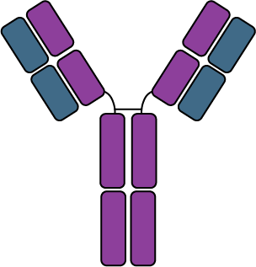
CLDN18.2 is a valid target:
Emerging CLDN18.2 Targeted Treatments
Monoclonal antibody
Humanized mAb
Engineered mAb
BITE
Bispecific
ADCs
CAR-T
Cytotoxic granules
Anti-CLDN18.2scFv
TCR
CM311
CD8ɑ hinge
T cell
CD28 co-stim domain
CD3ζ activating domain
CD3
AMG 910
CAR-T Cell
CMG901
CLDN18.2
CMG901, EO-3021
TPX4589
RC118
LM302
SOT102
SKB315
JS107
IBI343
Fc mutations to enhance ADCC
IMAB306/zolbetuximab TST-001
ABI011, MIL93, ZL1211
CT-041, LCAR-C18S
LY011
AMG910/ASP2138 (CD3), Q-1802 (PD-L1)
TJCD4B (4-1BB)
PT886 (CD47)

Slide 39
Targeting FGFR2 in
Gastroesophageal Adenocarcinoma

Slide 40
FIGHT Trial Design
Key Eligibility Criteria
No prior therapy for unresectable LA or mG/GEJ adenocarcinoma
RECIST v1.1 evaluable disease
FGFR2b overexpression by IHC
and/or FGFR2 gene amplification by ctDNA*
ECOG 0/1
HER2 not positive
May receive 1 dose of mFOLFOX6
Double blind, placebo controlled
Bema + mFOLFOX6
(n=77)
Primary endpoint
Investigator-assessed
PFS
Secondary endpoints
OS
Response rate
R
1:1
VS
Placebo + mFOLFOX6
(n=78)
Stratification Factors
Geographic region
Single dose of mFOLFOX6 during screening
Prior adjuvant or neoadjuvant chemotherapy
Treatment Q2W†
Statistical Plan
Trial initially designed as registrational phase 3 (n=548) with 2-sided 𝝰 0.05
amended after enrolling n=155 to a proof-of-concept phase 2 with prespecified
statistical assumptions of:
﻿Hierarchical sequential testing: PFS, then OS/ORR
﻿≥84 events to demonstrate benefit at a HR ≤0.76 for PFS at 2-sided 𝝰 of 0.2
*Central testing: IHC stain (Ventana): cut-off any
2+/3+; circulating tumor DNA (PGDx): cut-off 1.5X.
†15 mg/kg Q2W with a single 7.5-mg/kg dose on Cycle 1 Day 8.
Wainberg ZA. ASCO GI 2021. Abstract LBA160. Wainberg ZA et al. Lancet Oncol. 2022;23(11):1430-40.

Slide 41
FIGHT: First-Line Bemarituzumab + mFOLFOX6 vs Placebo + mFOLFOX6 in Advanced Gastric/GEJ Cancer
Randomized phase 2 trial of bemarituzumab (anti-FGFR2b antibody) or placebo + (both + mFOLFOX6) for patients with no prior therapy and unresectable LA or mG/GEJ adenocarcinoma with FGFR2b overexpression/amplification (N=155)
1.00
9-mo rate
12-mo rate
1.00
0.75
PFS probability
0.75
65.3%
0.50
52.5%
OS probability
0.50
0.25
0.25
56.9%
33.8%
0
0
0
3
6
9
12
15
18
0
3
6
9
12
15
18
21
Mo
Mo
 | Bema + mFOLFOX6 (n=77) | Placebo + mFOLFOX6 (n=78)
Median PFS, mo | 9.5 | 7.4 | HR 0.68; P=0.0727
Median OS, mo | Not reached | 12.9 | HR 0.58; P=0.0268
Wainberg ZA. ASCO GI 2021. Abstr LBA160. Wainberg ZA et al. Lancet Oncol. 2022;23(11):1430-40.
Notes:
Bema, bemarituzumab; mFOLFOX6, modified leucovorin + fluorouracil + oxaliplatin.

Slide 42
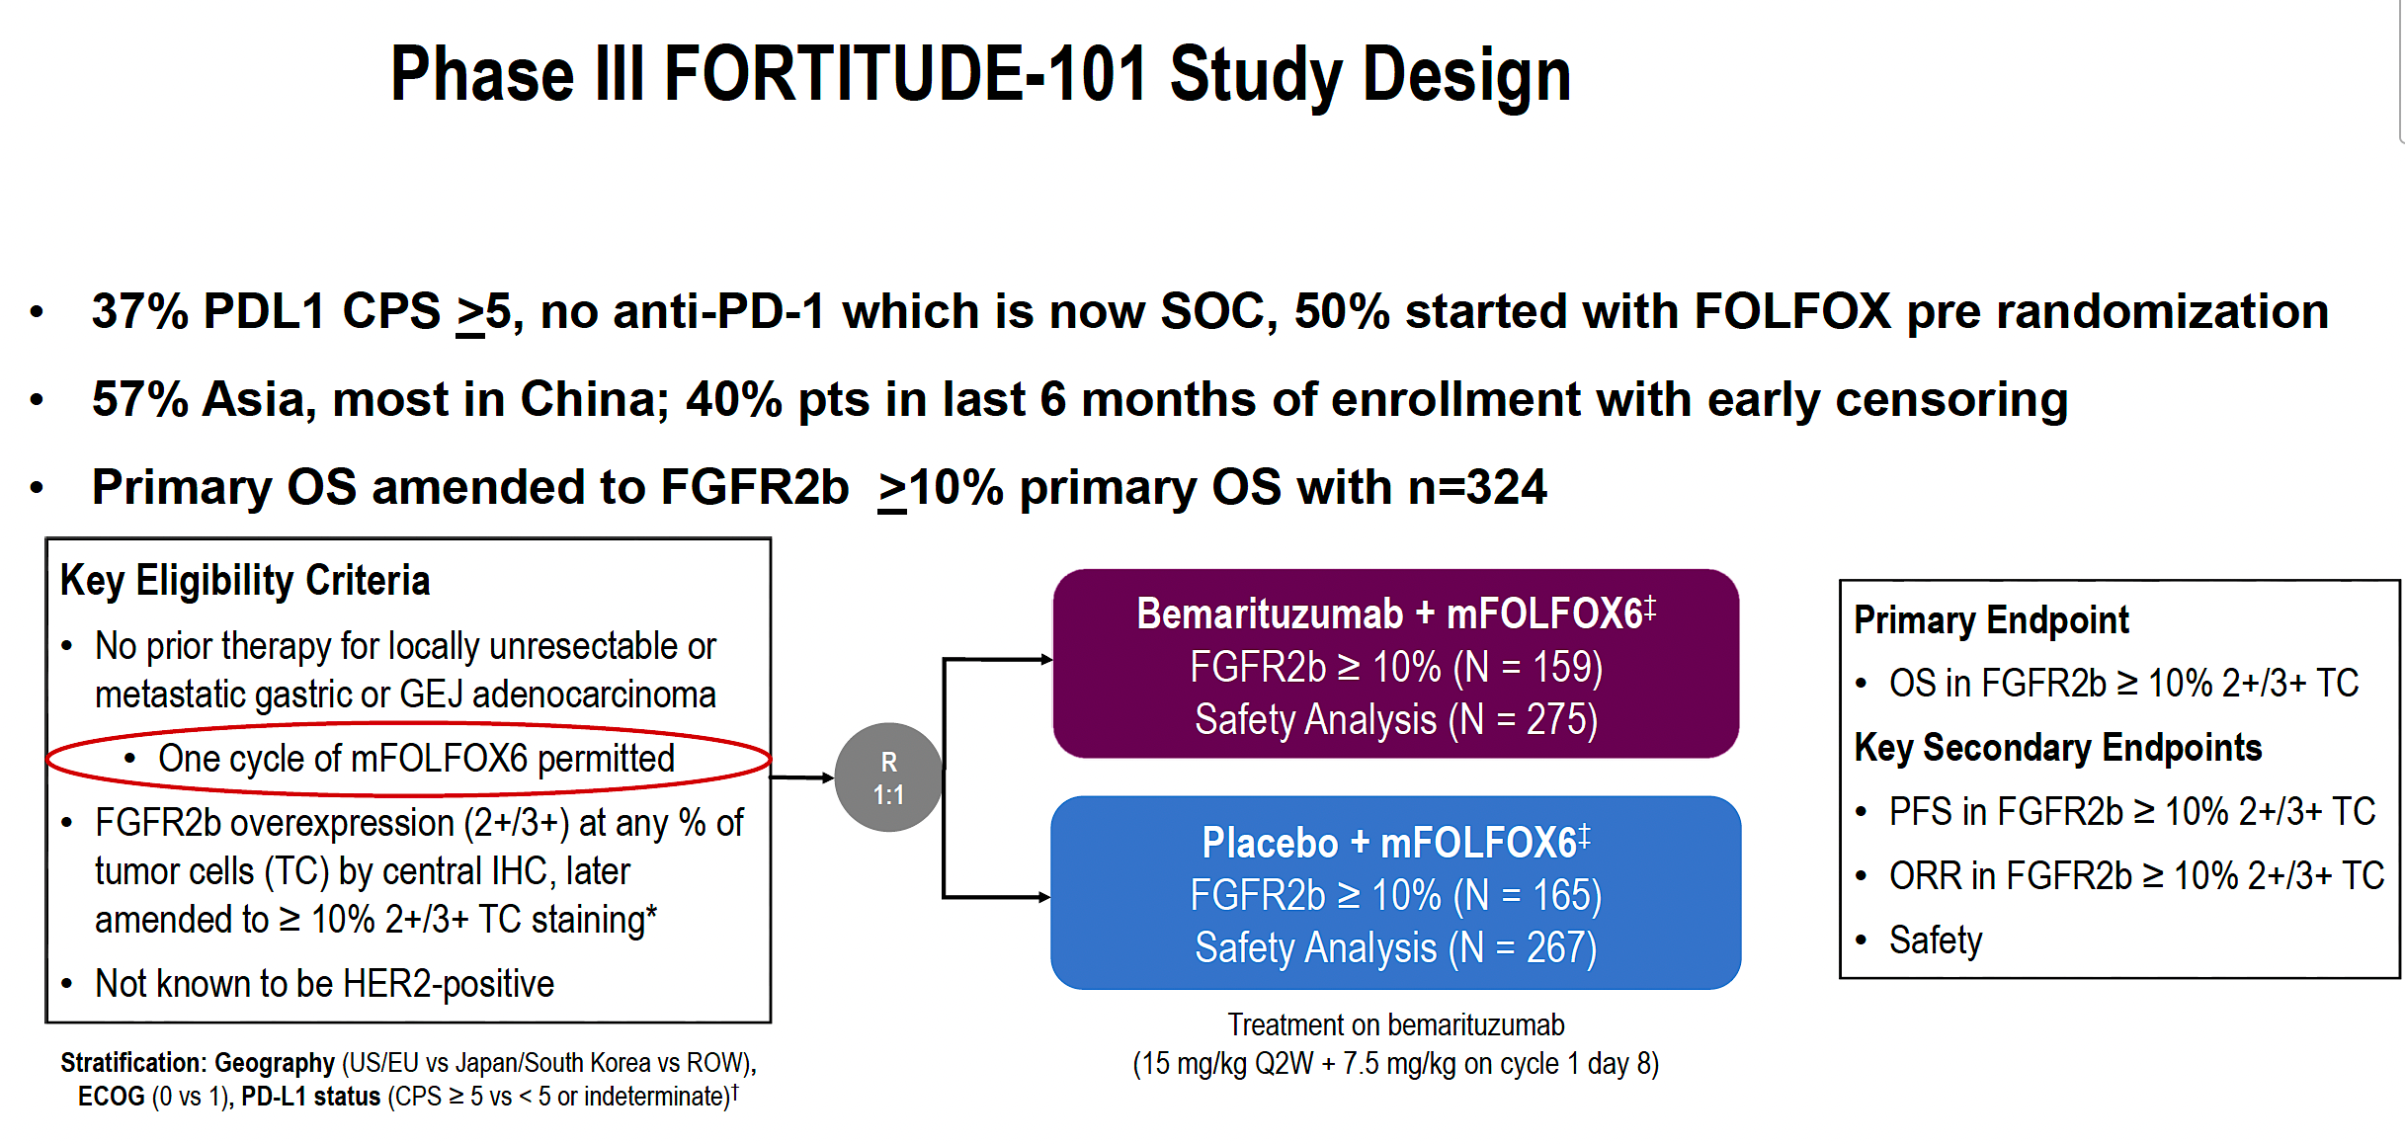
Rha SY et al. ESMO 2025;Abstract LBA10

Slide 43
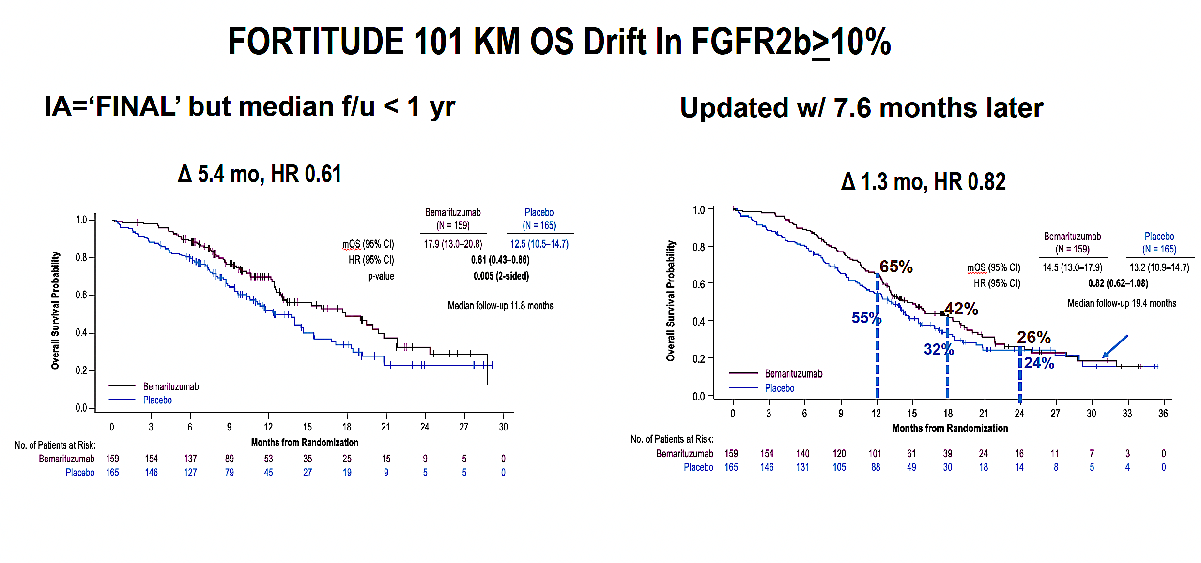
Rha SY et al. ESMO 2025;Abstract LBA10

Slide 44
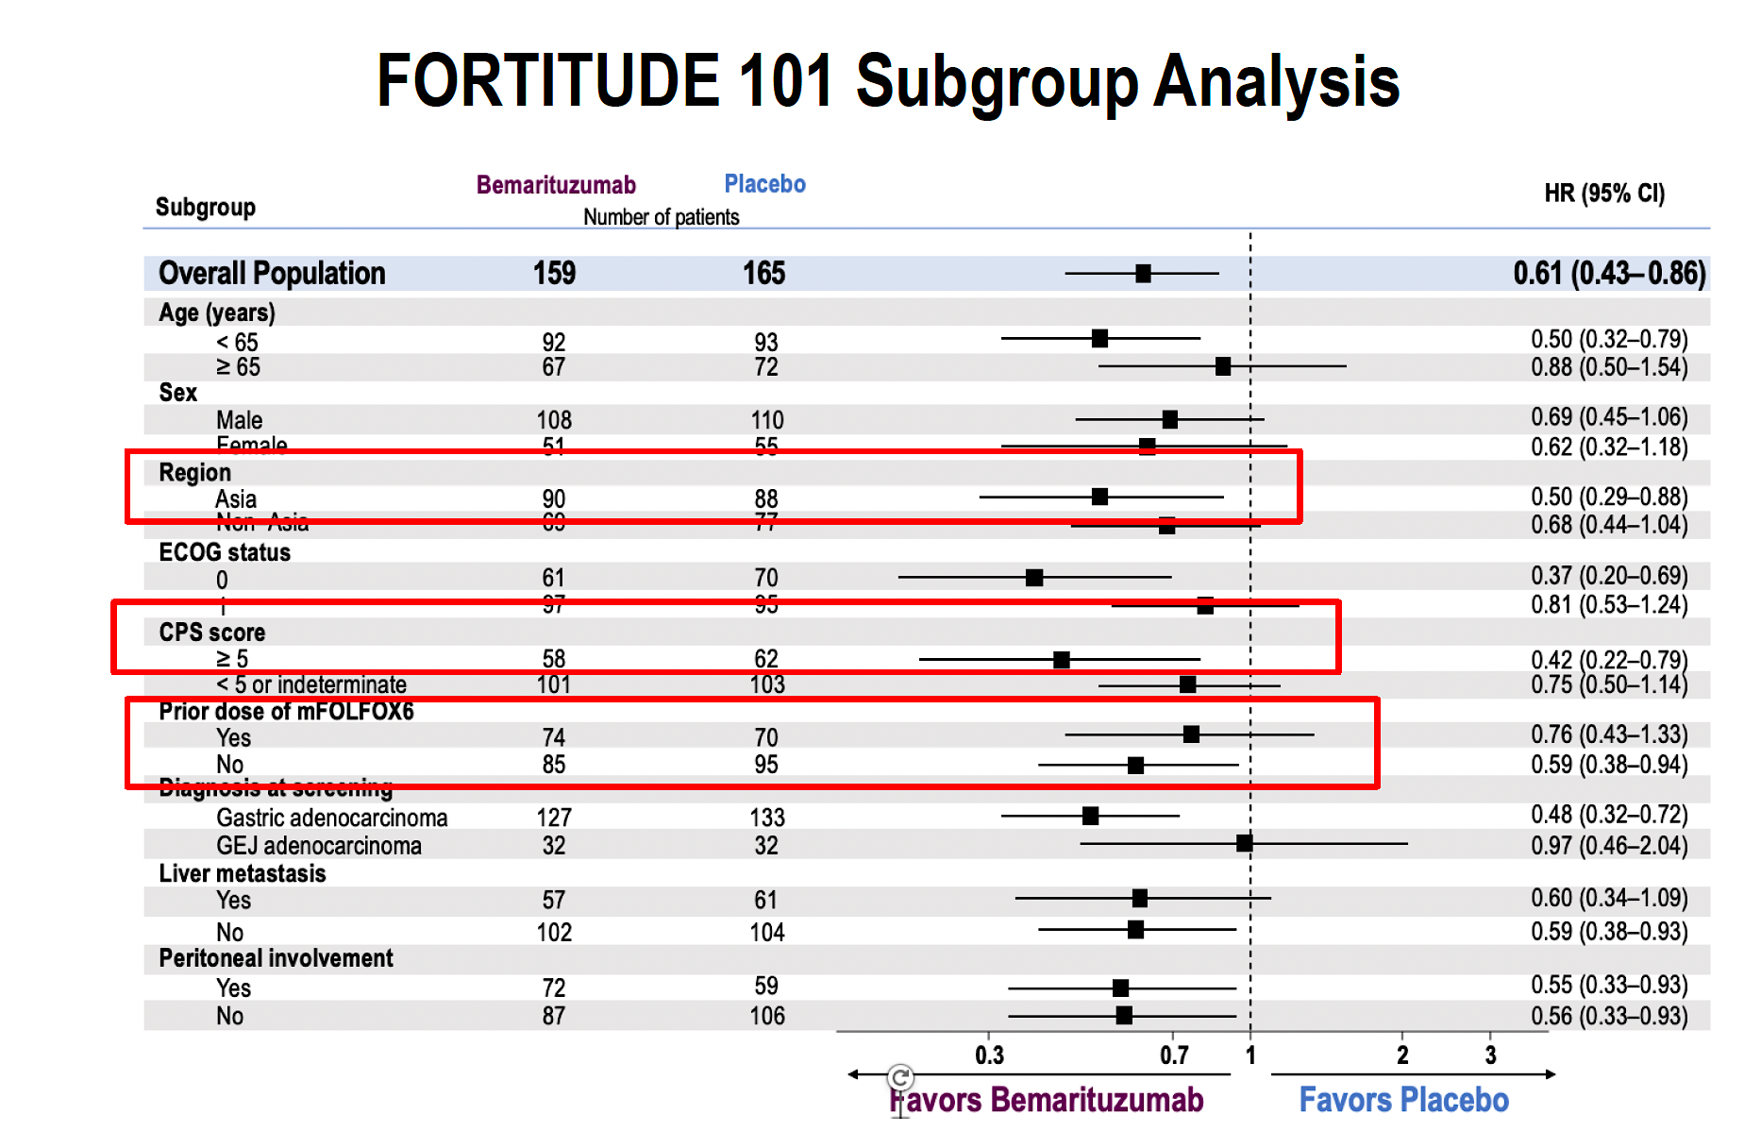
Rha SY et al. ESMO 2025;Abstract LBA10

Slide 45
Conclusions
Critical to obtain Biomarkers to optimally treat advanced Gastric/ GEJ adenocarcinoma
  PD-L1
  HER2
  CLDN18.2
  FGFR2
  TIGIT
Immunotherapy + chemotherapy for PD-L1 positive Gastric/GEJ adeno
CLDN18.2 positive tumors – zolbetuximab
HER2 – chemotherapy + pembrolizumab + trastuzumab

Slide 46

Case Presentation: 51-year-old man with MSI-high localized esophageal adenocarcinoma
Dr Brian Mulherin (Indianapolis, Indiana)

Slide 47
QUESTIONS FOR THE FACULTY
What is the optimal approach to treatment for this patient?
If the MATTERHORN regimen were to become available,
would you most likely opt for it or neoadjuvant/
perioperative immune checkpoint inhibition alone for a patient with resectable MSI-H/dMMR disease?
If this patient had received the MATTERHORN approach in the neoadjuvant setting and achieved a pCR, how would you have approached adjuvant therapy? What if he had received neoadjuvant immunotherapy only without chemotherapy?

Slide 48
QUESTIONS FOR THE FACULTY
If the MATTERHORN regimen were to become available for patients, in which patients will you prioritize the use of this strategy? Would you have any hesitation about adding durvalumab to FLOT for a patient with PD-L1-negative disease?

Slide 49
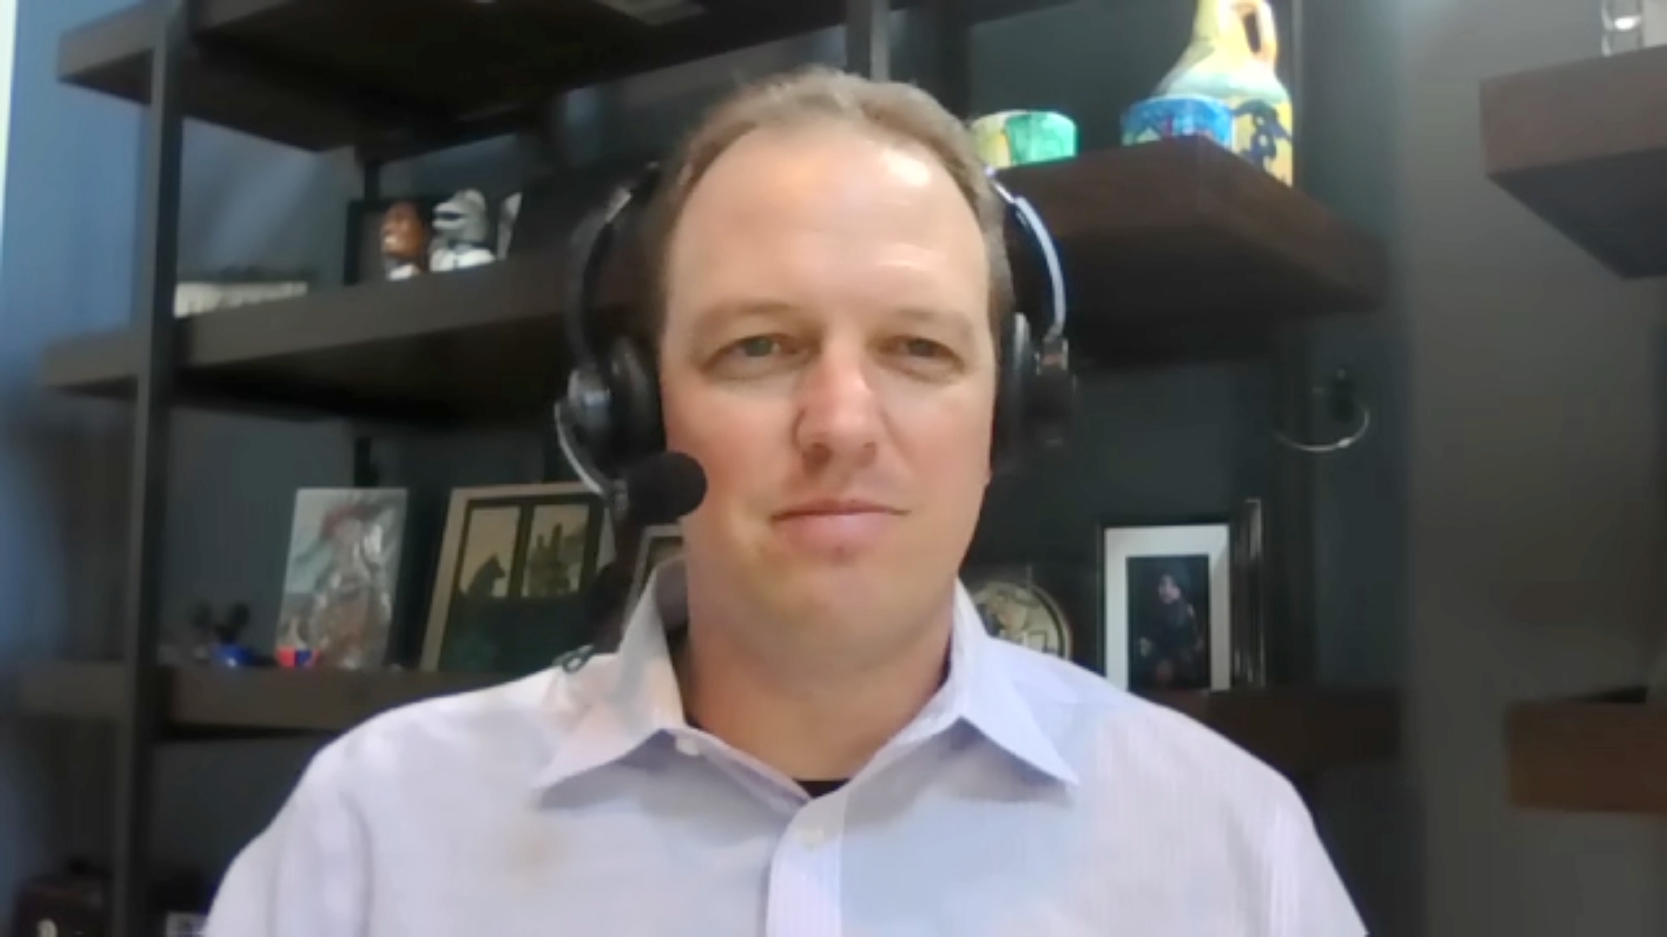
Case Presentation: 68-year-old woman with HER2-positive (IHC 3+) and HER2 TKD-mutant metastatic esophageal adenocarcinoma
Dr Sean Warsch (Asheville, North Carolina)

Slide 50
QUESTIONS FOR THE FACULTY
How would you approach maintenance therapy for this patient going forward?
Do you rebiopsy all patients with HER2-positive gastroesophageal cancers after progression on first-line HER2-targeted therapy?
What second-line therapy would you recommend for this patient? After seeing the results of DESTINY-Gastric04, are there any situations in which you would not recommend
T-DXd as second-line therapy and opt for ramucirumab/
paclitaxel or something else instead?

Slide 51
QUESTIONS FOR THE FACULTY
How do you manage nausea and other GI toxicities with T-DXd?

Slide 52
Case Presentation: 73-year-old woman with HER2-positive (IHC 3+), PD-L1-negative, CLDN18.2-negative metastatic gastric cancer
Dr Brian Mulherin (Indianapolis, Indiana)

Slide 53
QUESTIONS FOR THE FACULTY
How do you screen for ILD with T-DXd, and do all patients need to be monitored using scans or can they be monitoring clinically with scans ordered only for those with symptoms?

Slide 54
QUESTIONS FOR THE FACULTY
How do you envision zanidatamab being employed in HER2-positive gastroesophageal cancers?
If both zanidatamab and T-DXd were available for HER2-positive gastroesophageal cancers, which one would you prioritize and why? Does zanidatamab offer any mechanistic advantages, given that it is a bispecific antibody?
What are the most common side effects associated with zanidatamab, and how can they be managed? How would
you indirectly compare the global tolerability/toxicity of zanidatamab to that of T-DXd?

Slide 55
QUESTIONS FOR THE FACULTY
Given that zanidatamab is available in biliary tract cancers, are there any situations in which you would attempt to access it for a patient with HER2-positive gastroesophageal cancer outside of a clinical trial today?

Slide 56

Case Presentation: 73-year-old woman with metastatic GEJ adenocarcinoma (PD-L1 CPS 15) who begins treatment with FOLFOX/nivolumab and subsequently is found to have CLDN18.2 overexpression
Dr Zanetta Lamar (Naples, Florida)

Slide 57
QUESTIONS FOR THE FACULTY
When do you typically conduct CLDN18.2 testing for your patients with advanced gastroesophageal cancers, and what assay do you use? Is CLDN18.2 reported on commercially available NGS platforms?
For patients with newly diagnosed gastric/GEJ adenocarcinoma that expresses both CLDN18.2 and PD-L1, do you generally opt for anti-PD-1 antibody/chemotherapy or zolbetuximab/ chemotherapy? Would you ever offer both an anti-PD-1
antibody and zolbetuximab?

Slide 58
QUESTIONS FOR THE FACULTY
What would you most likely recommend when this patient’s disease progresses? For a patient with CLDN18.2-positive disease who had already received first-line therapy, would you attempt to employ zolbetuximab in a later line?

Slide 59
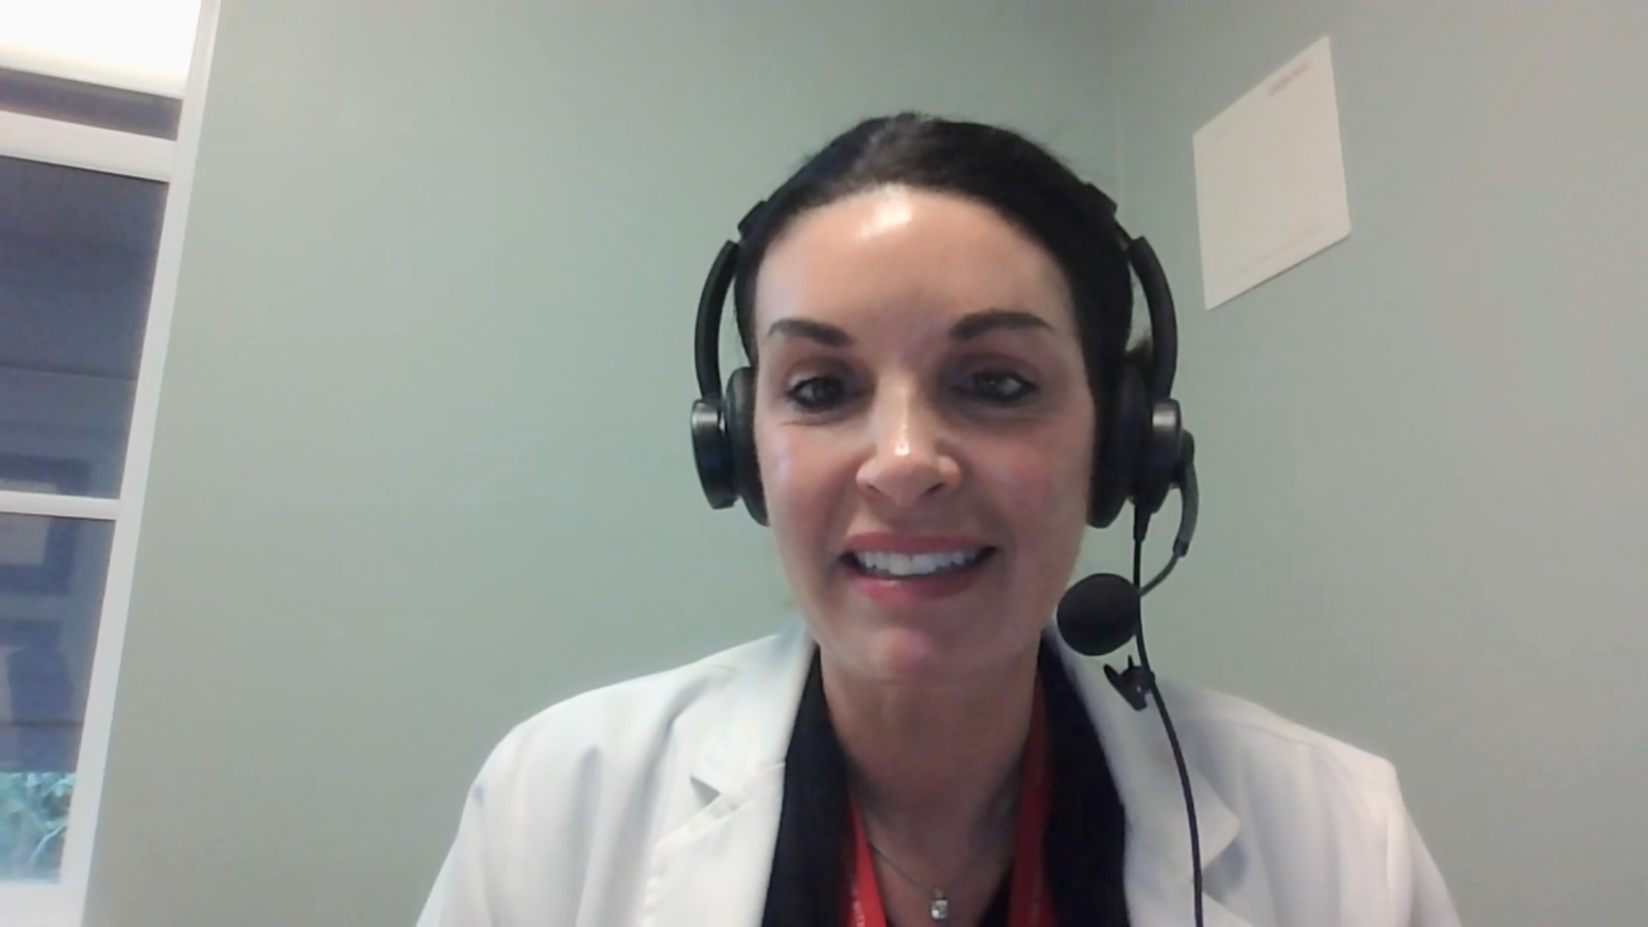
Case Presentation: 45-year-old man with CLDN18.2-positive metastatic esophageal adenocarcinoma (PD-L1 10%) who receives mFOLFOX6 and zolbetuximab
Dr Jennifer Yannucci (Savannah, Georgia)

Slide 60
QUESTIONS FOR THE FACULTY
What has been your experience with the efficacy and tolerability of zolbetuximab/chemotherapy? Would you have treated this patient any differently?
Have you found any strategies to be particularly helpful for mitigating/managing zolbetuximab-associated nausea and vomiting?

Slide 61
Integrating New Advances into the Care of Patients with Cancer
A Multitumor Symposium in Partnership with the American Oncology Network
CME/MOC, NCPD and ACPE Accredited
Saturday, November 8, 2025
10:00 AM – 3:00 PM CT

Slide 62
Thank you for joining us!
Your feedback is very important to us.
How to Obtain CME/MOC, NCPD and ACPE Credit
In-person attendees: Please refer to the program syllabus for the credit link or QR code.
Online/Zoom attendees: The credit link is posted in the chat room.

