Slide 1
Integrating New Advances into the Care of Patients with Cancer A Multitumor Symposium in Partnership with the American Oncology Network
CME/MOC, NCPD and ACPE Accredited
Saturday, November 8, 2025 10:00 AM – 3:00 PM CT

Slide 2
Agenda
Module 1 — Lung Cancer: Drs Gainor, Langer and Shields
Module 2 — Chronic Lymphocytic Leukemia: Dr Rogers
Module 3 — Ovarian Cancer: Dr Konecny
Module 4 — Gastroesophageal Cancers: Dr Shah

Slide 3


Ovarian Cancer Faculty
Gottfried E Konecny, MD
Professor of Medicine and Ob/Gyn
Director, Medical Gynecologic Oncology
Division of Hematology and Oncology
David Geffen School of Medicine
University of California, Los Angeles
Los Angeles, California
MODERATOR
Stephen "Fred" Divers, MD
Chief Medical Officer
American Oncology Network
Hot Springs, Arkansas

Slide 4
Dr Konecny — Disclosures
No relevant conflicts of interest to disclose.

Slide 5
Dr Divers — Disclosures
Advisory Committees | Daiichi Sankyo Inc

Slide 6
Snapshot of AON Practice Ovarian Cancer

Slide 7
Snapshot of AON Practice Ovarian Cancer — PARP Inhibitors

Slide 8
Snapshot of AON Practice Ovarian Cancer — Antibody-Drug Conjugates

Slide 9

Updates in Ovarian Cancer 2025 Gottfried E. Konecny M.D. University of California Los Angeles

Slide 10
Update on PARP Inhibitors
Novel Antibody Drug Conjugates
Immunotherapy in Recurrent Disease
Inhibiting the Glucocorticoid Receptor

Slide 11
PARP Inhibitors in Ovarian Cancer 2023
PARP Inhibitors in Ovarian Cancer 2025
Upfront maintenance
Plat Sens Rec (maintenance post chemo)
Plat Sens Rec (treatment)
Plat Res Rec (treatment)
Population
BRCA
mutated
Phase
ARIEL 4 (rucaparib v chemo)
SOLO-3 (olaparib vs chemo)
III
SOLO-1 (olaparib)
SOLO-2 (olaparib)
II
ARIEL 2 (rucaparib)
QUADRA (niraparib)
QUADRA (niraparib)
(*BRCAm or HRD)
III
PAOLA-1 (olaparib/bev*)
III
PRIMA (niraparib)
ATHENA-MONO (rucaparib)
Study 19 (olaparib)
NOVA (niraparib)
ARIEL3 (rucaparib)
AVANOVA2 (niraparib+/-bev)
All Comers
II
OVARIO (niraparib/bev)
Notes:
#ARIEL 4: BRCAm PS and PR: DHCP letter: detrimental effect in OS for rucaparib c/w chemotherapy (19.4 months rucaparib, 25.4 chemo) HR 1.31 (95% CI: 1.00, 1.73), p= 0.0507
¥ SOLO 3 PS OvCa, non-plat chemo vs. olaparib detrimental effect in OS for olaparib c/w chemotherapy (29.9 months olaparib, 39.4 chemo) HR 1.33 (95% CI: 0.84, 2.18), p= 0.0507
@ NOVA May 2022, November 2022

Slide 12
2016 - PFS
NOVA – Niraparib as Maintenance
2022 - OS
NEJM
Dear Health Care Letter
gBRCAmut OS was 43.6 months for niraparib vs. 41.6 months for placebo (HR = 0.93 [95% CI 0.63, 1.36])
Non-gBRCAmut, HRDpos OS was 37.3 months for niraparib vs 41.4 months for placebo (HR = 1.32 [95% CI 0.84, 2.06])
Non-gBRCAmut
OS was 31.1 months for niraparib vs. 36.5 months for placebo (HR = 1.10 [95% CI 0.83, 1.46])
Notes:
DoR = duration of response
ECOG = Eastern Cooperative Oncology Group
ICR = independent central review
IHC = immunohistochemistry
MSI-H = microsatellite instability high
ORR = objective response rate
OS = overall survival
PCR = polymerase chain reaction
PD = progressive disease
PFS = progression-free survival
PS = performance status
Q3W = every 3 weeks
CI = confidence interval
CR = complete response
DoR= duration of response
NR = not reached
ORR = objective response rate
OS = overall survival
PFS = progression-free survival
PR = partial response
association between response to pembrolizumab treatment and tTMB was a prespecified exploratory biomarker objective. We assessed all efficacy endpoints in the tTMB-high (≥10 mutations per megabase) and non-tTMB-high (<10 mutations per megabase) groups.
Marabelle A, Le DT, Ascierto PA, et al. Efficacy of pembrolizumab in patients with noncolorectal high microsatellite instability/mismatch repair-deficient cancer: results from the phase II KEYNOTE-158 study. J Clin Oncol. 2020;38(1):1-10.

Slide 13
MDS/AML in Randomized Ovarian Cancer PARP Inhibitor Maintenance Trials
 |  |  | PARPi | MDS/AML Events by arm
Trial | Setting | Agent | Duration | PARPi, n (%) | Comparator, n (%)
SOLO1⁴ | 1L maint | Olaparib | 2 years | 3/260 (1.5) | 1/130 (0.8)
PRIMA⁶ | 1L maint | Niraparib | 3 years | 1/484 (<1) | 0/244
PAOLA1⁵ | 1L maint | Olaparib | 2 years | 6/535 (1) | 1/267 (0.4)
ATHENA MONO⁹ | 1L maint | Rucaparib | 2 years | 2/425 (0.5) | 0/110
Study19⁸ | PS maint | Olaparib | UDP, 18% >3yrs | 2/136 (1.5) | 1/129 (<1)
SOLO2² | PS maint | Olaparib | UDP, mean 29.1 mos | 16/195 (8) | 4/99 (4)
NOVA³ | PS maint | Niraparib | UDP | 13/367 (3.5) | 3/179 (1.7)
gBRCAm |  |  |  | 9/136 (6.6) | 2/65 (3.1)
non-gBRCAm |  |  |  | 4/231 (1.7) | 1/114 (0.9)
ARIEL3⁷ | PS maint | Rucaparib | UDP, median 8.3 mos | 14/375 (3.8) | 6/189 (3.2)
PARPi >24m¹⁰ |  |  |  | 9/79 (11.4)
non-gBRCAm |  |  |  | 5/245 (2.0) | 1/123 (0.8)
gBRCAm |  |  |  | 9/130 (6.9) | 3/63 (4.8)
PARPi >24 mos |  |  |  | 7/46 (15.2)
²Poveda A, et al. Lancet Oncol 2021, ³Matulonis U. et al. SGO 2021, ⁴DiSilvestro P, et al. J Clin Oncol 2022, ⁵Ray-Coquard I et al. NEJM Dec 2019, ⁶Gonzalez-Martin A et al. NEJM 2019, ⁷Coleman RL et al. IGCS 2022, ⁸Lederman J et al. Lancet 2016 17: 1579-89, ⁹Monk B et al. J Clin Oncol 2022, ¹⁰O’Malley et al. Gyn Onc 10/2022
Notes:
1L maint – maintenance treatment after completion of first line chemotherapy treatment
PS maint – maintenance treatment after completion of second line or greater platinum sensitive chemotherapy treatment
UDP - until disease progression
Median time to onset of MDS/AML 17.8 months¹
¹Morice P-M, et al. Lancet Haematol 2021;8:e122-e134,

Slide 14
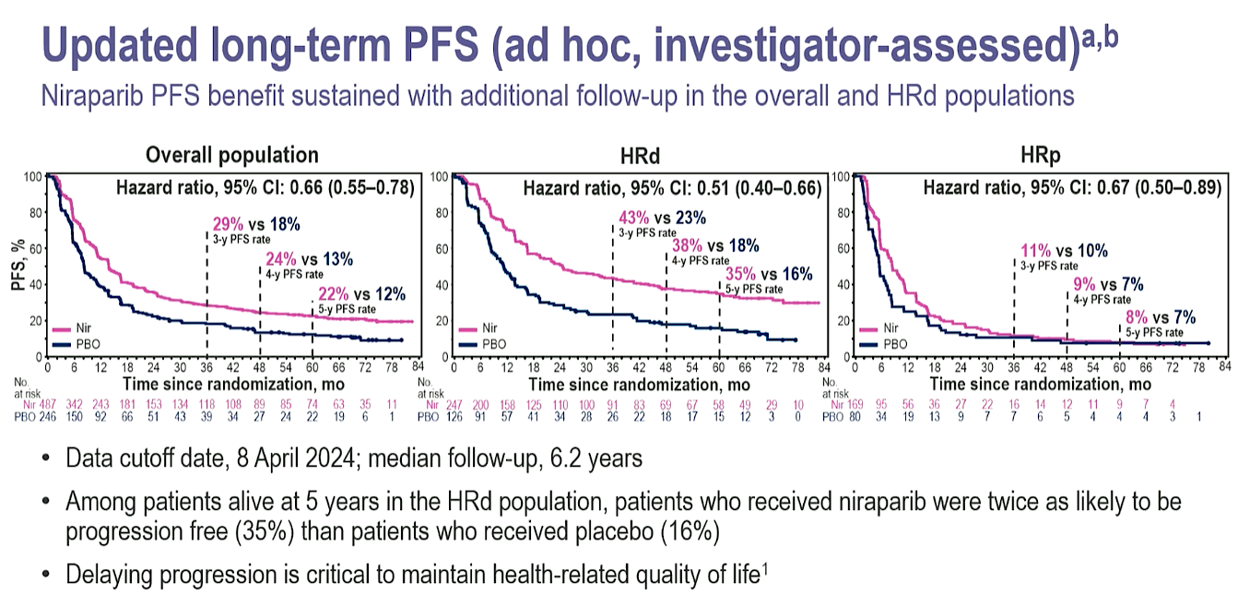

Slide 15
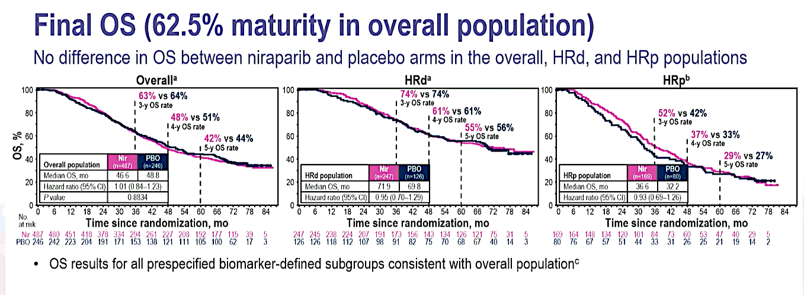

Slide 16
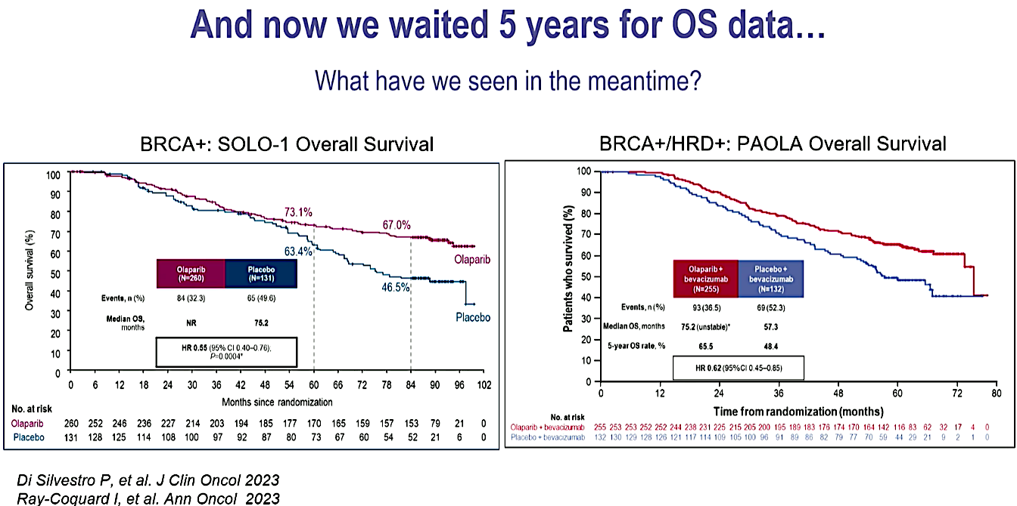

Slide 17
Update on PARP Inhibitors
Novel Antibody Drug Conjugates
Immunotherapy in Recurrent Disease
Inhibiting the Glucocorticoid Receptor

Slide 18
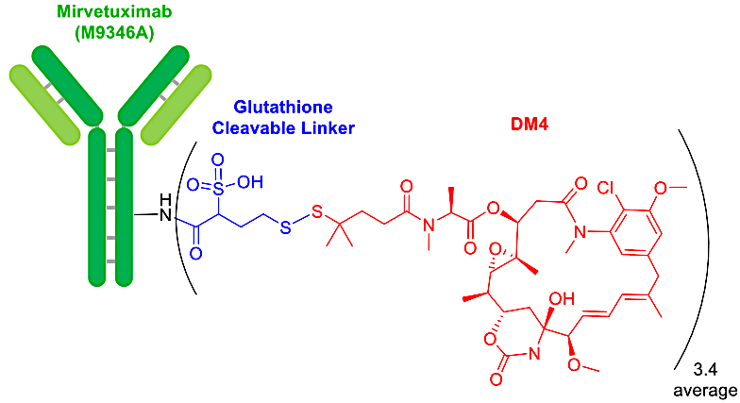
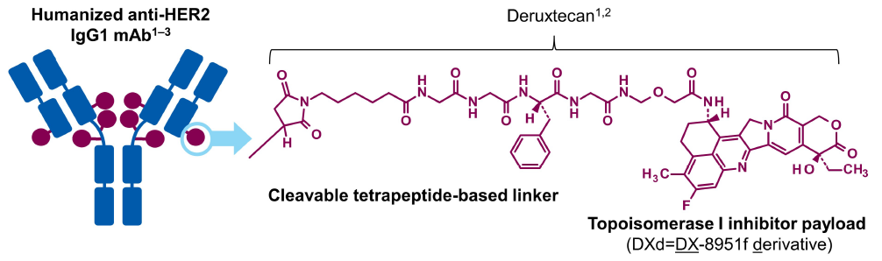
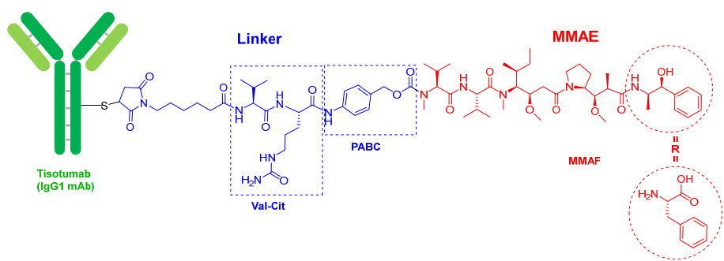
ADCs FDA Approved for Gynecologic Cancer
 | Mirvetuximab soravtansine (MIRV)^{1,2} | Trastuzumab deruxtecan (T-DXd)^{3,4} | Tisotumab vedotin^{5,6}
Target | FRα | HER2 | Tissue factor
Payload | DM4 | Topoisomerase I inhibitor | MMAE (microtubule disruptor)
Regulatory Status | Ovarian: Full FDA approval | HER2 IHC 3+ tumor agnostic: accelerated FDA | Cervical Cancer: Full FDA approval
Pivotal Trial | MIRASOL | DESTINY-PanTumor02 | InnovaTV-301
Structure
1. Mirvetuximab soravtansine. Prescribing information. https://www.accessdata.fda.gov/drugsatfda_docs/label/2024/761310Origs005lbl.pdf; 2. de la Torre BG, & Albericio F. Molecules. 2023;28(3):1038.; 3. Trastuzumab deruxtecan. Prescribing information. https://www.accessdata.fda.gov/drugsatfda_docs/label/2024/761139s028lbl.pdf;
4. Meric-Bernstam F, et al. ASCO 2023. Abstract LBA3000; 5.Tisotumab vedotin-tftv. Prescribing information https://www.accessdata.fda.gov/drugsatfda_docs/label/2024/761208s007lbl.pdf; 6. de la Torre BG & Albericio F. Molecules. 2022;27(3):1075.

Slide 19
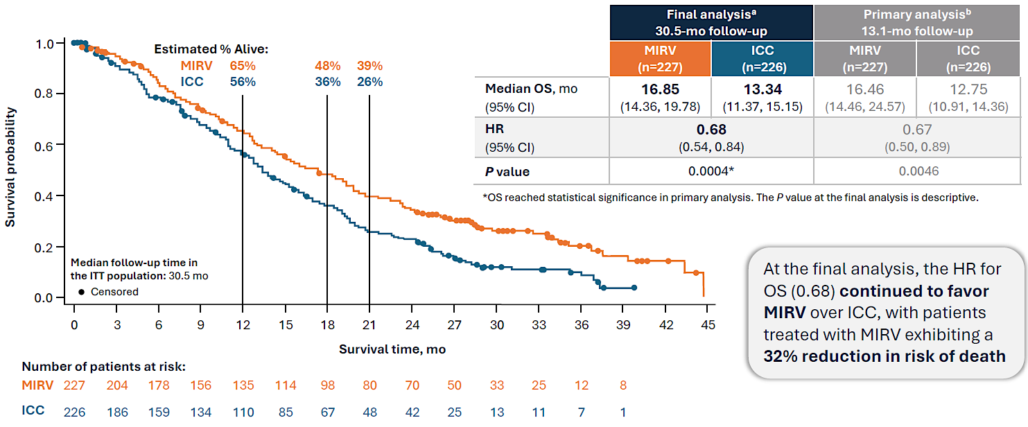
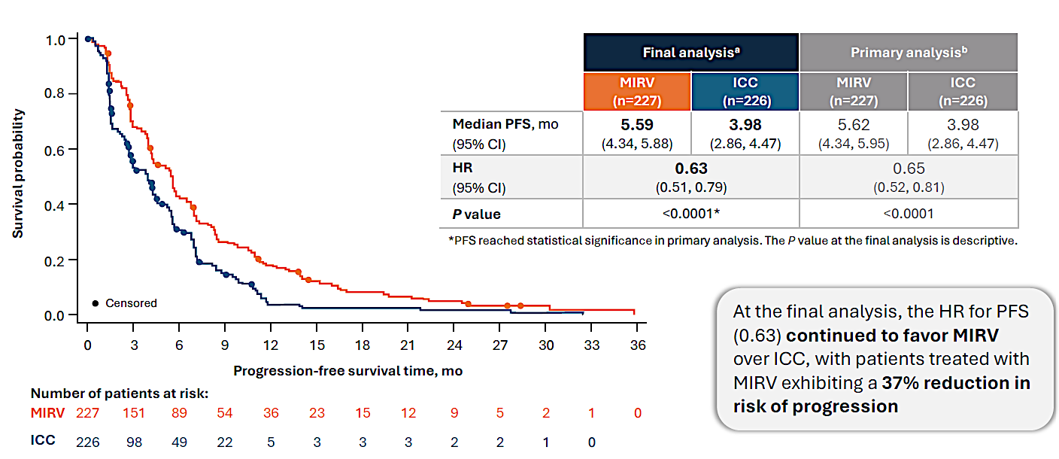
MIRASOL: Final OS and PFS
Overall Survival
Progression-Free Survival
Van Gorp T, et al. SGO 2025. Abstract 939696.

Slide 20
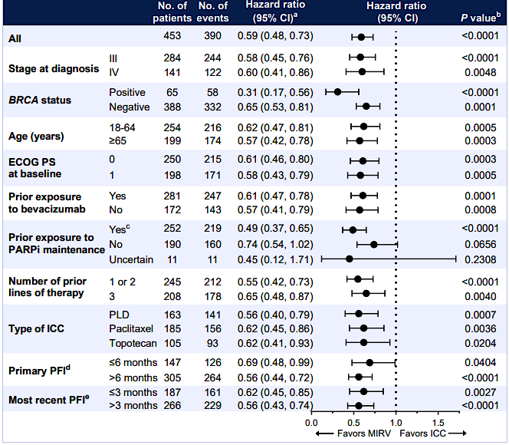
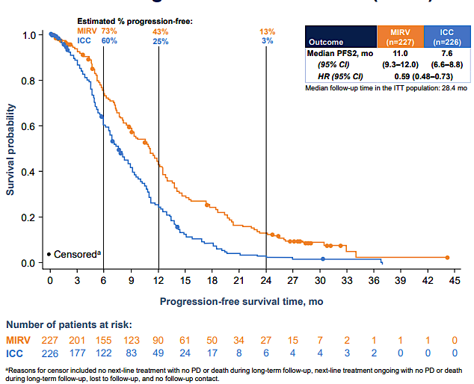
MIRASOL: PFS2
PFS2 ITT Population
(Median follow-up 28.4 mo)
PFS2 by Baseline Clinicodemographic Subgroups
Moore K, et al. ESMO 2025. Abstract 1068P.

Slide 21
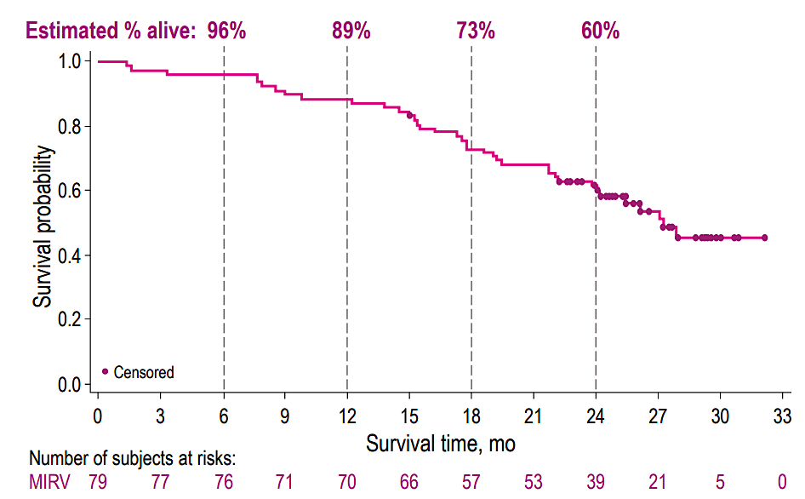
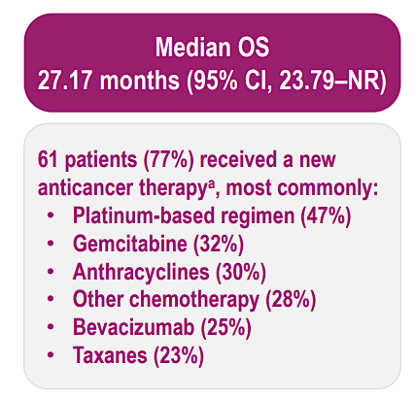
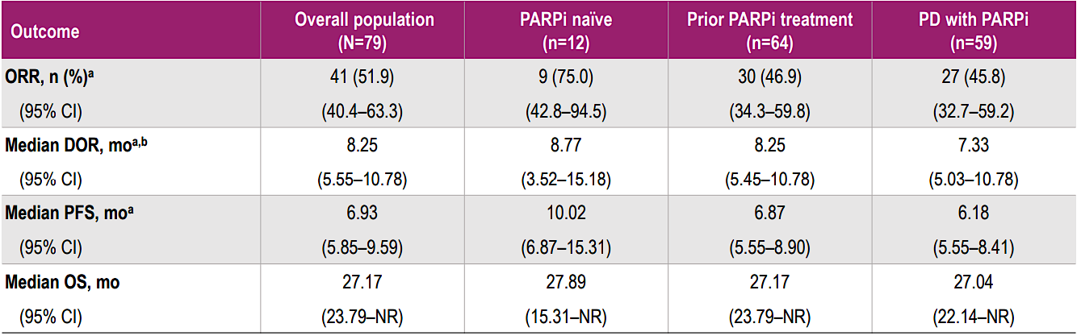
PICCOLO: Final OS and Efficacy Summary with Mirvetuximab Soravtansine
Number of subjects at risk:
Alvarez Secord A, et al. ESMO-GC 2025. Abstract 76MO.

Slide 22
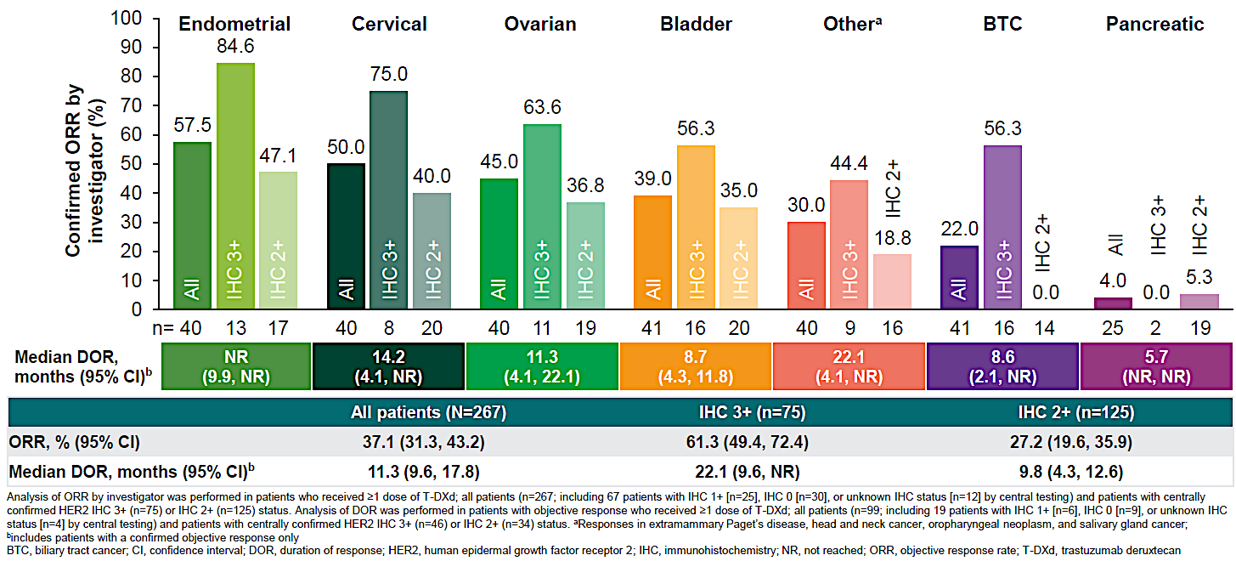
DESTINY-PanTumor02: Objective Response Rate
Meric-Bernstam F. EMSO 2023. Abstract LBA34. .

Slide 23
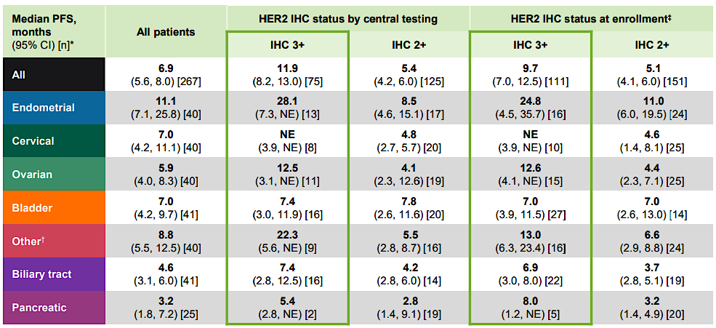
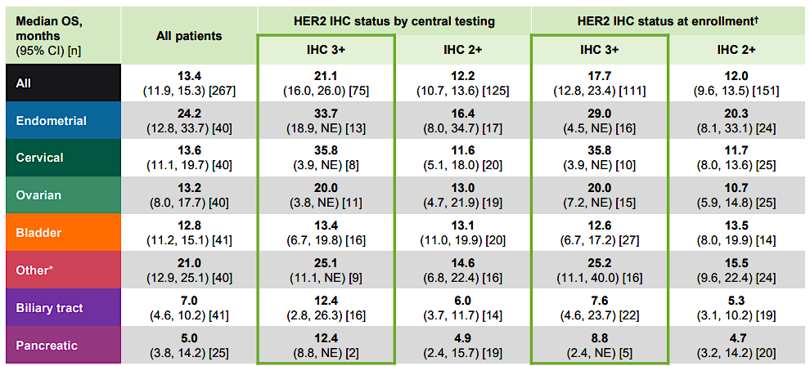
DESTINY-PanTumor02 Secondary Endpoints – Final PFS and OS (Investigator Assessed)
mPFS
mOS
Makker V, et al. ESMO 2025. Abstract 957P.

Slide 24
Novel Deruxtecan ADCs in Development
ADC | Datopotamab deruxtecan (Dato-DXd) | Raludotatug deruxtecan (R-DXd) | Ifinatamab Deruxtecan (I-DXd)
Gynecological Malignancy | Ovarian & Endometrial | Ovarian, Endometrial & Cervical | Ovarian, Endometrial & Cervical
Target | TROP2 | CDH6 | B7-H3
Target Expression | Highly expressed in a majority of ovarian and endometrial cancers¹ | Minimal expression in normal tissue but aberrantly expressed and linked to poorer prognosis in many solid tumors² | Minimal or no expression in normal tissues but highly expressed in many solid tumors³
Payload | Exatecan (Topoisomerase I inhibitor)
Key Trials for Gynecologic Cancer | TROPION-PanTumor03 | REJOICE-PanTumor01 REJOICE-Ovarian01 | Ideate-PanTumor02
Development Stage | Phase 3 | Phase 2/3 | Phase 1/2
Development Status | Ongoing | Ongoing | Ongoing
1. Oaknin A et al. ESMO 2024. Abstract 714MO; 2. Albiges L et al. ASCO 2025. Abstract TPS3158; 3. Kogawa T et al. ASCO 2025. Abstract TPS3157.

Slide 26
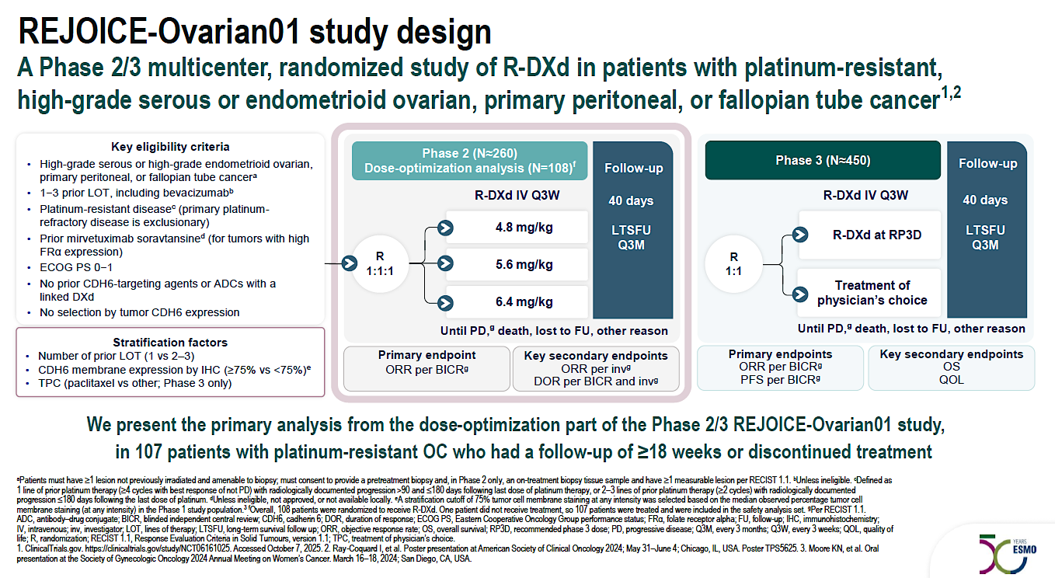

Slide 27
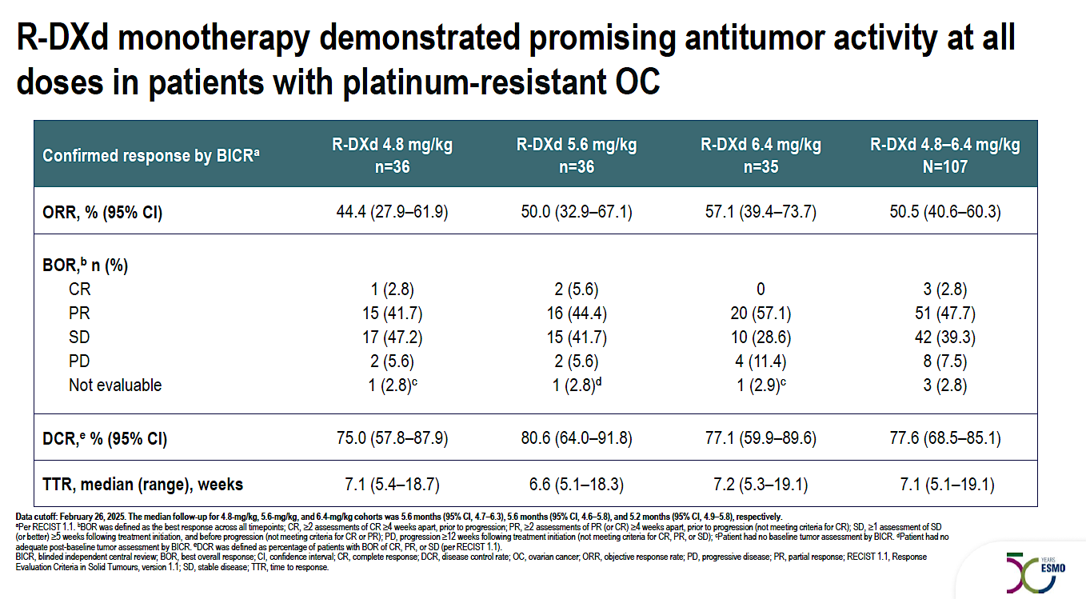

Slide 28
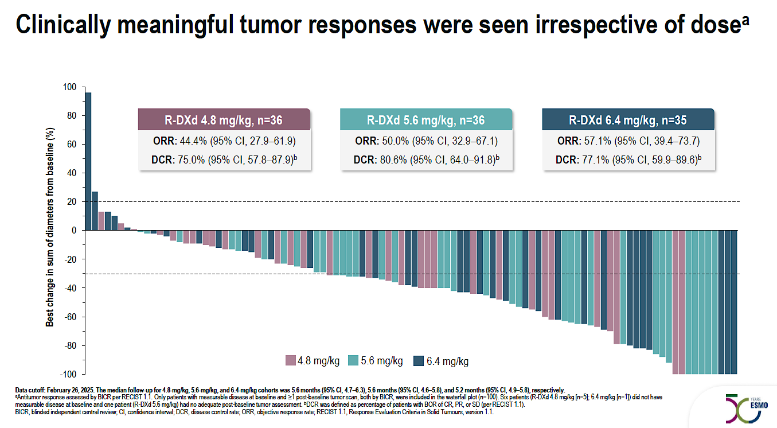

Slide 29
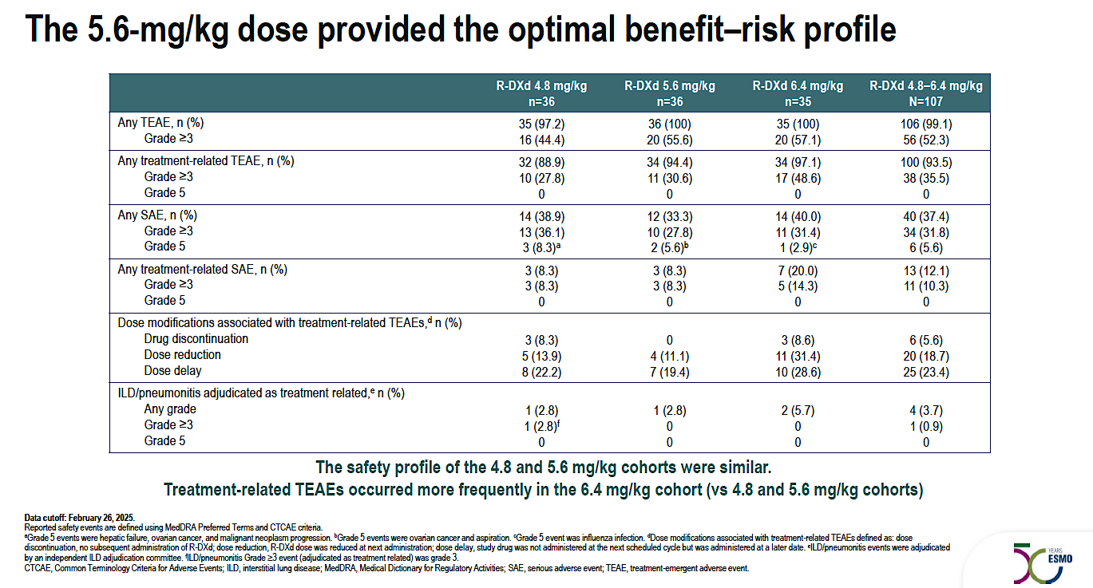

Slide 30
Update on PARP Inhibitors
Novel Antibody Drug Conjugates
Immunotherapy in Recurrent Disease
Inhibiting the Glucocorticoid Receptor

Slide 31
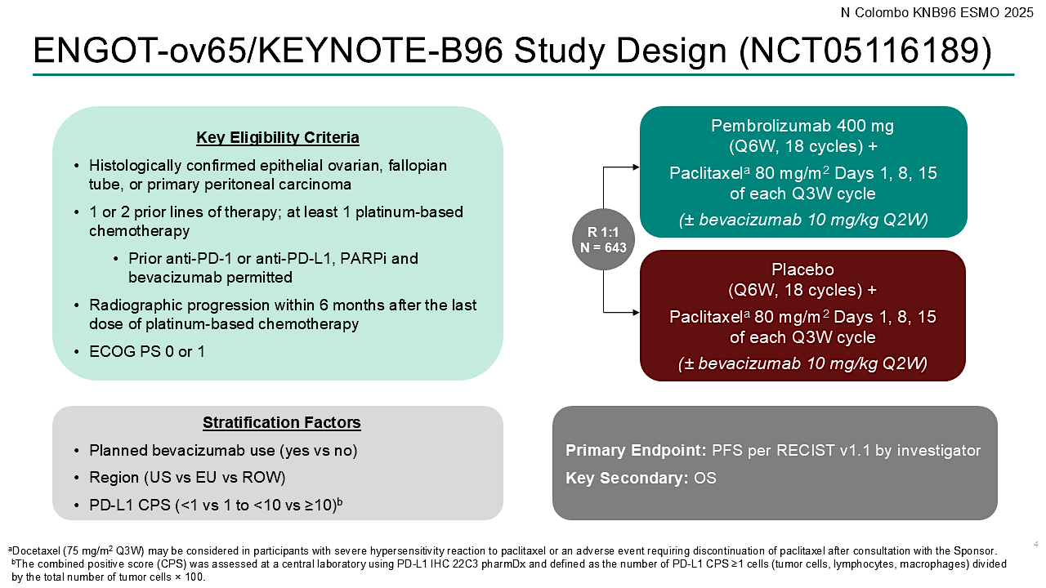

Slide 32
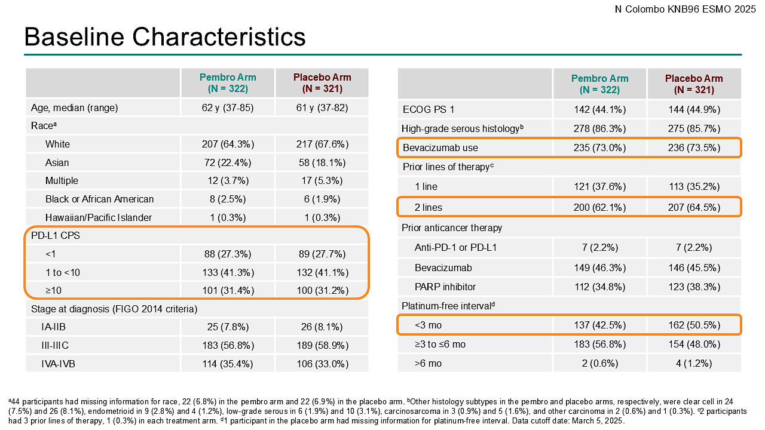

Slide 33
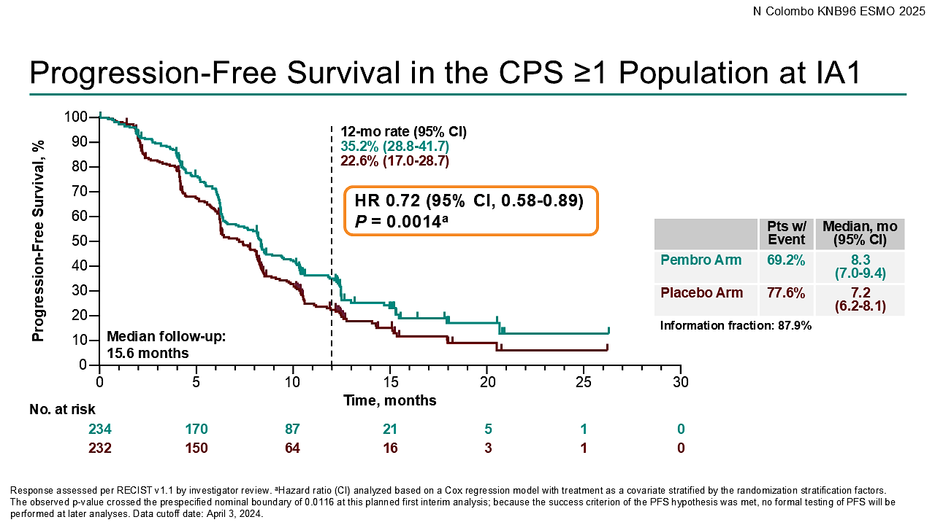

Slide 34
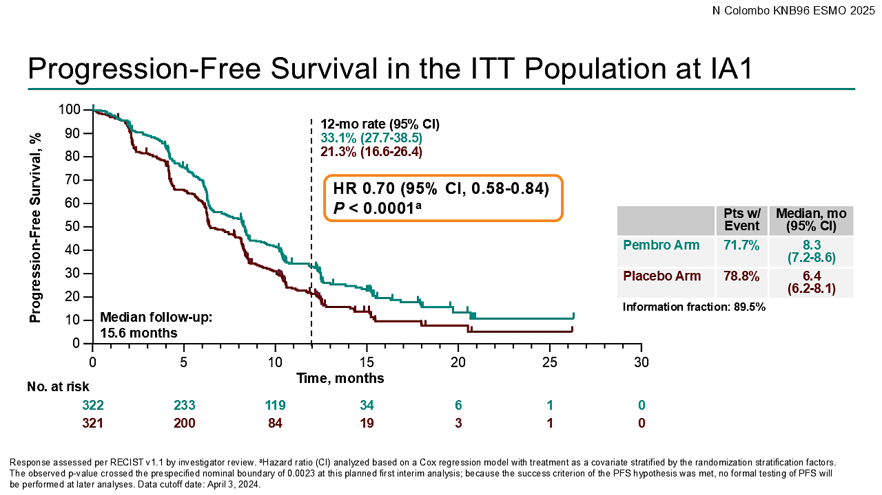

Slide 35
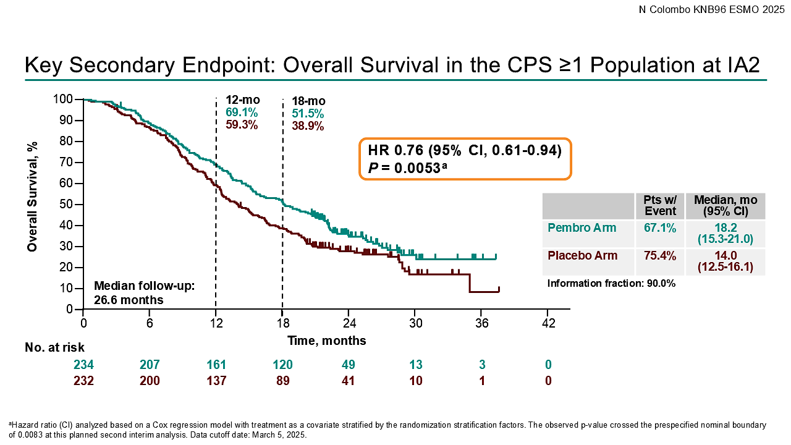

Slide 36
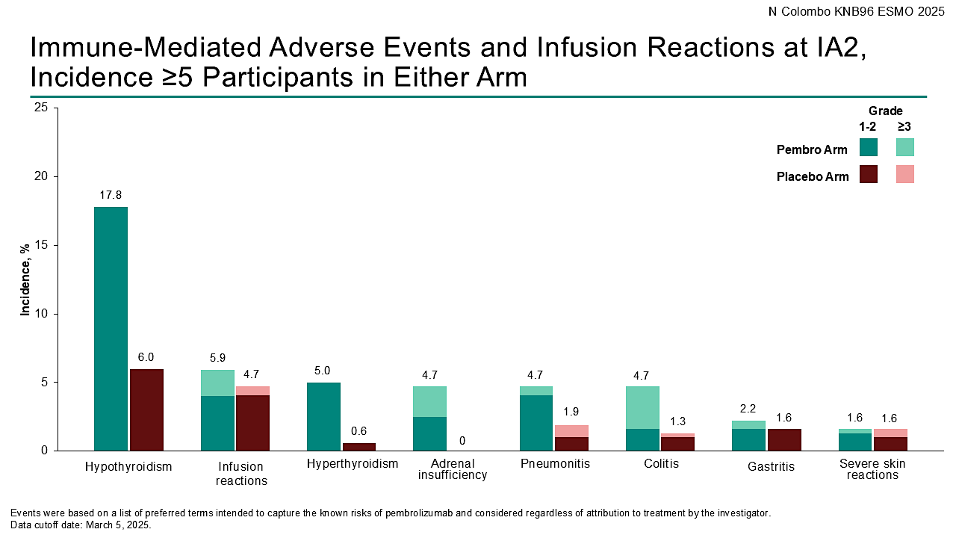

Slide 37
Phase 3 KEYNOTE-B96 Trial Met Secondary Endpoint of Overall Survival in All Comers Population of Patients With Platinum-Resistant Recurrent Ovarian Cancer
Press Release: October 16, 2025
The Phase 3 KEYNOTE-B96 trial, also known as ENGOT-ov65, met its secondary endpoint of overall survival (OS) for the treatment of patients with platinum-resistant recurrent ovarian cancer in all comers. The trial studied pembrolizumab in combination with chemotherapy (paclitaxel) with or without bevacizumab for these patients.
“As previously announced, KEYNOTE-B96 met its primary endpoint of progression-free survival PFS in patients with platinum-resistant recurrent ovarian cancer whose tumors express PD-L1 and in all comers, as well as its secondary endpoint of OS for patients whose tumors express PD-L1, at previous interim analyses.
Findings from these prior analyses will be presented in a Presidential Symposium at the upcoming European Society for Medical Oncology (ESMO) Congress 2025.”
https://www.merck.com/news/merck-announces-phase-3-keynote-b96-trial-met-secondary-endpoint-of-overall-survival-os-in-all-comers-population-of-patients-with-platinum-resistant-recurrent-ovarian-cancer/

Slide 38
Update on PARP Inhibitors
Novel Antibody Drug Conjugates
Immunotherapy in Recurrent Disease
Inhibiting the Glucocorticoid Receptor

Slide 39
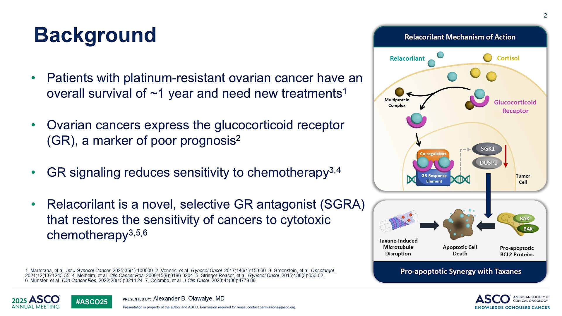
Background
Content of this presentation is the property of the author, licensed by ASCO. Permission required for reuse.

Slide 40
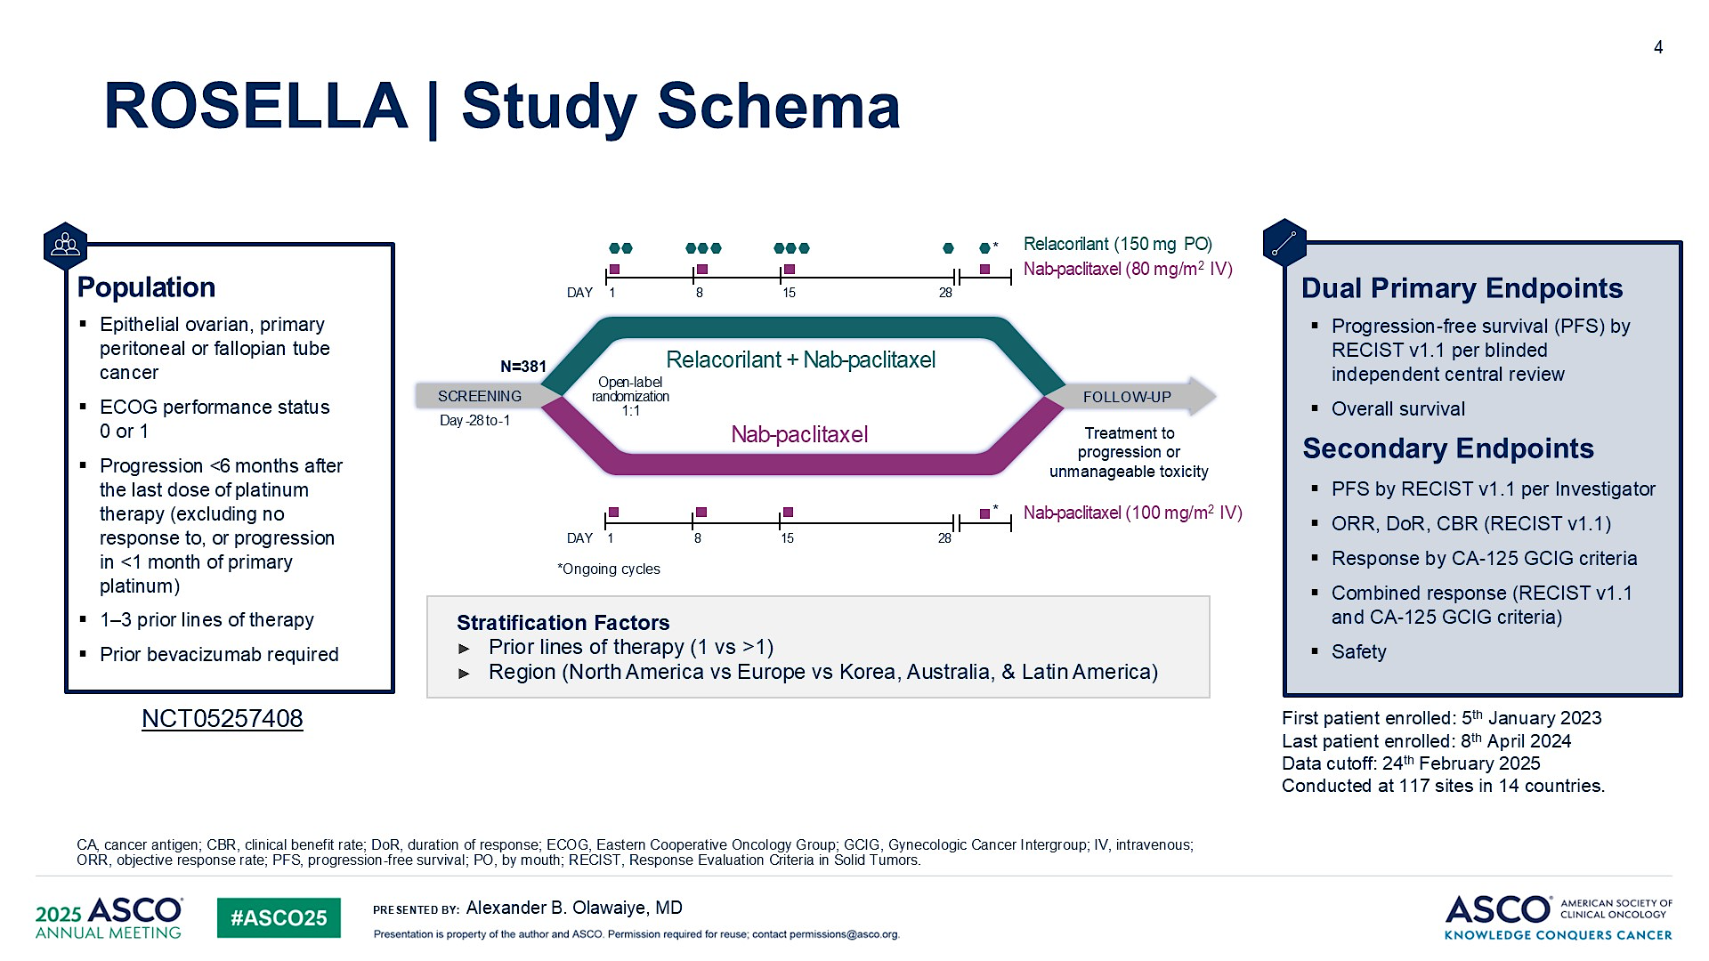
Slide 4
Content of this presentation is the property of the author, licensed by ASCO. Permission required for reuse.

Slide 41
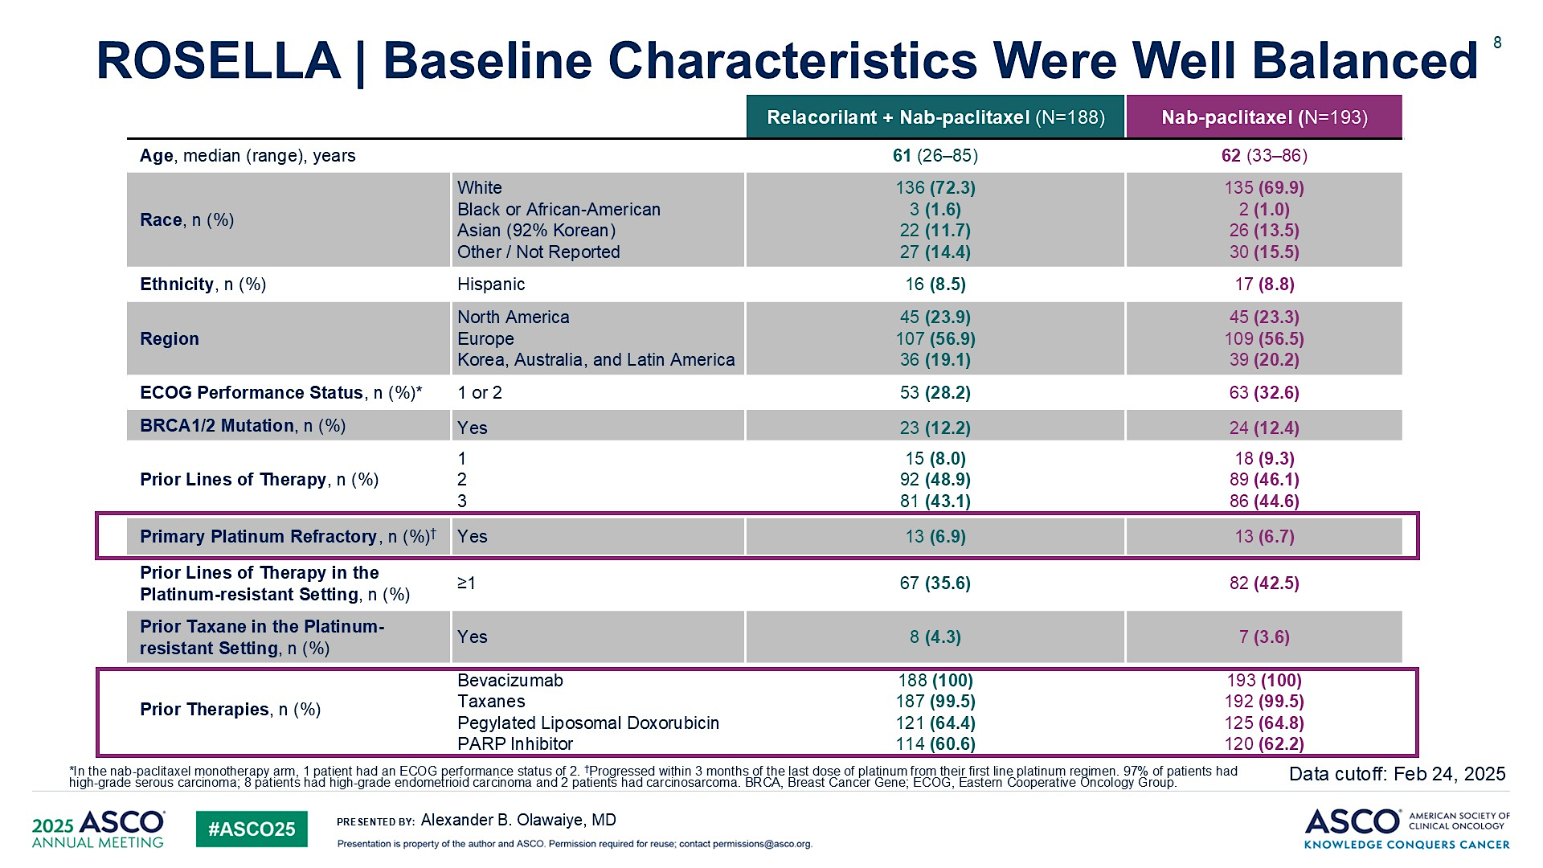
ROSELLA | Baseline Characteristics Were Well Balanced
Content of this presentation is the property of the author, licensed by ASCO. Permission required for reuse.

Slide 42
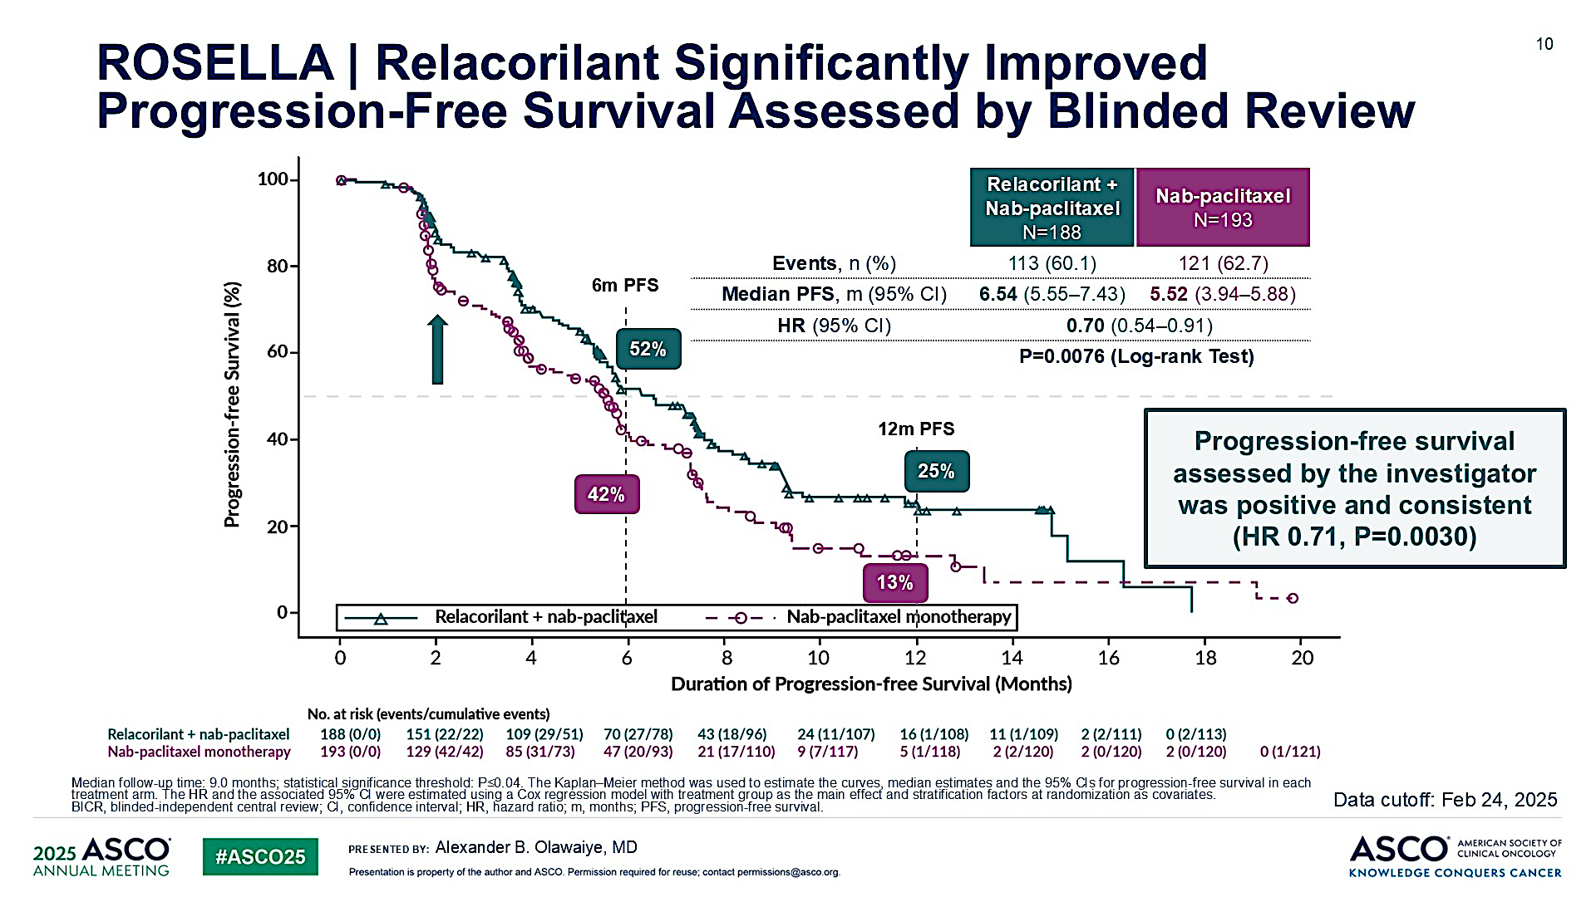
ROSELLA | Relacorilant Significantly Improved Progression-Free Survival Assessed by Blinded Review
Content of this presentation is the property of the author, licensed by ASCO. Permission required for reuse.

Slide 43
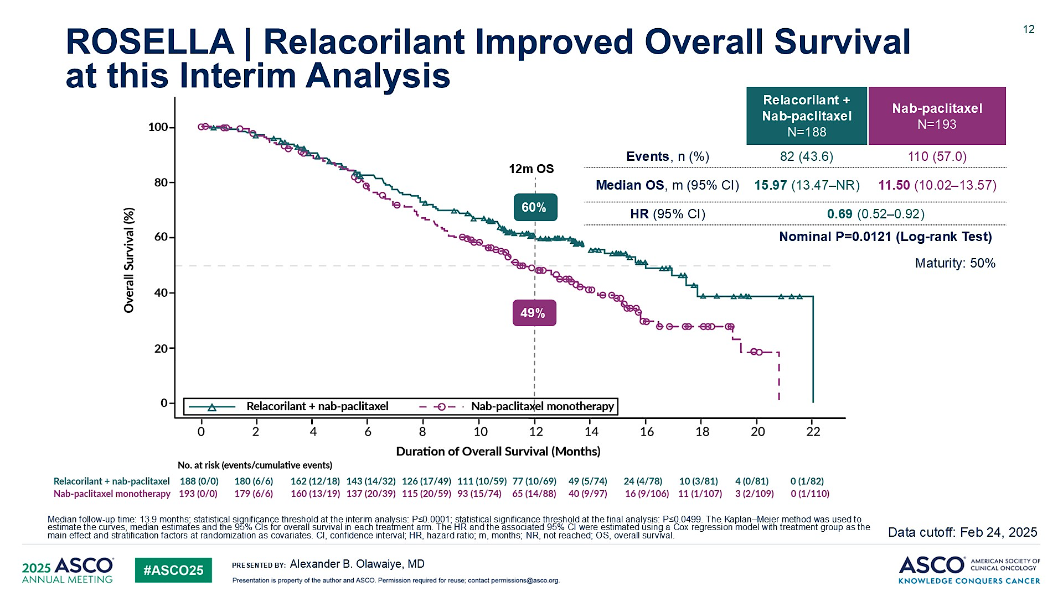
ROSELLA | Relacorilant Improved Overall Survival <br />at this Interim Analysis
Content of this presentation is the property of the author, licensed by ASCO. Permission required for reuse.

Slide 44
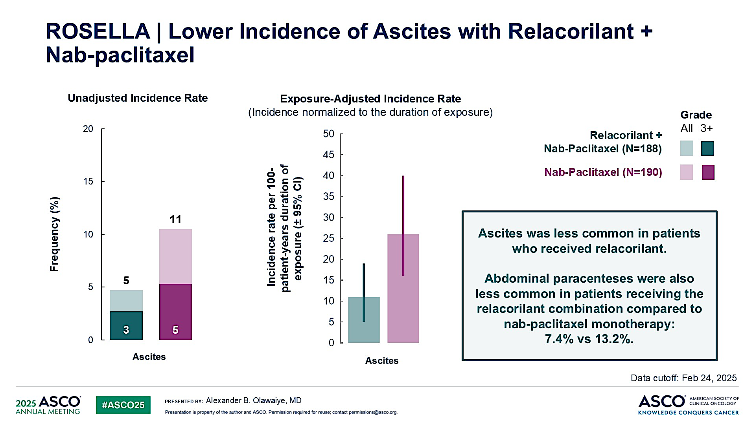
ROSELLA | Lower Incidence of Ascites with Relacorilant + <br />Nab-paclitaxel
Content of this presentation is the property of the author, licensed by ASCO. Permission required for reuse.

Slide 45
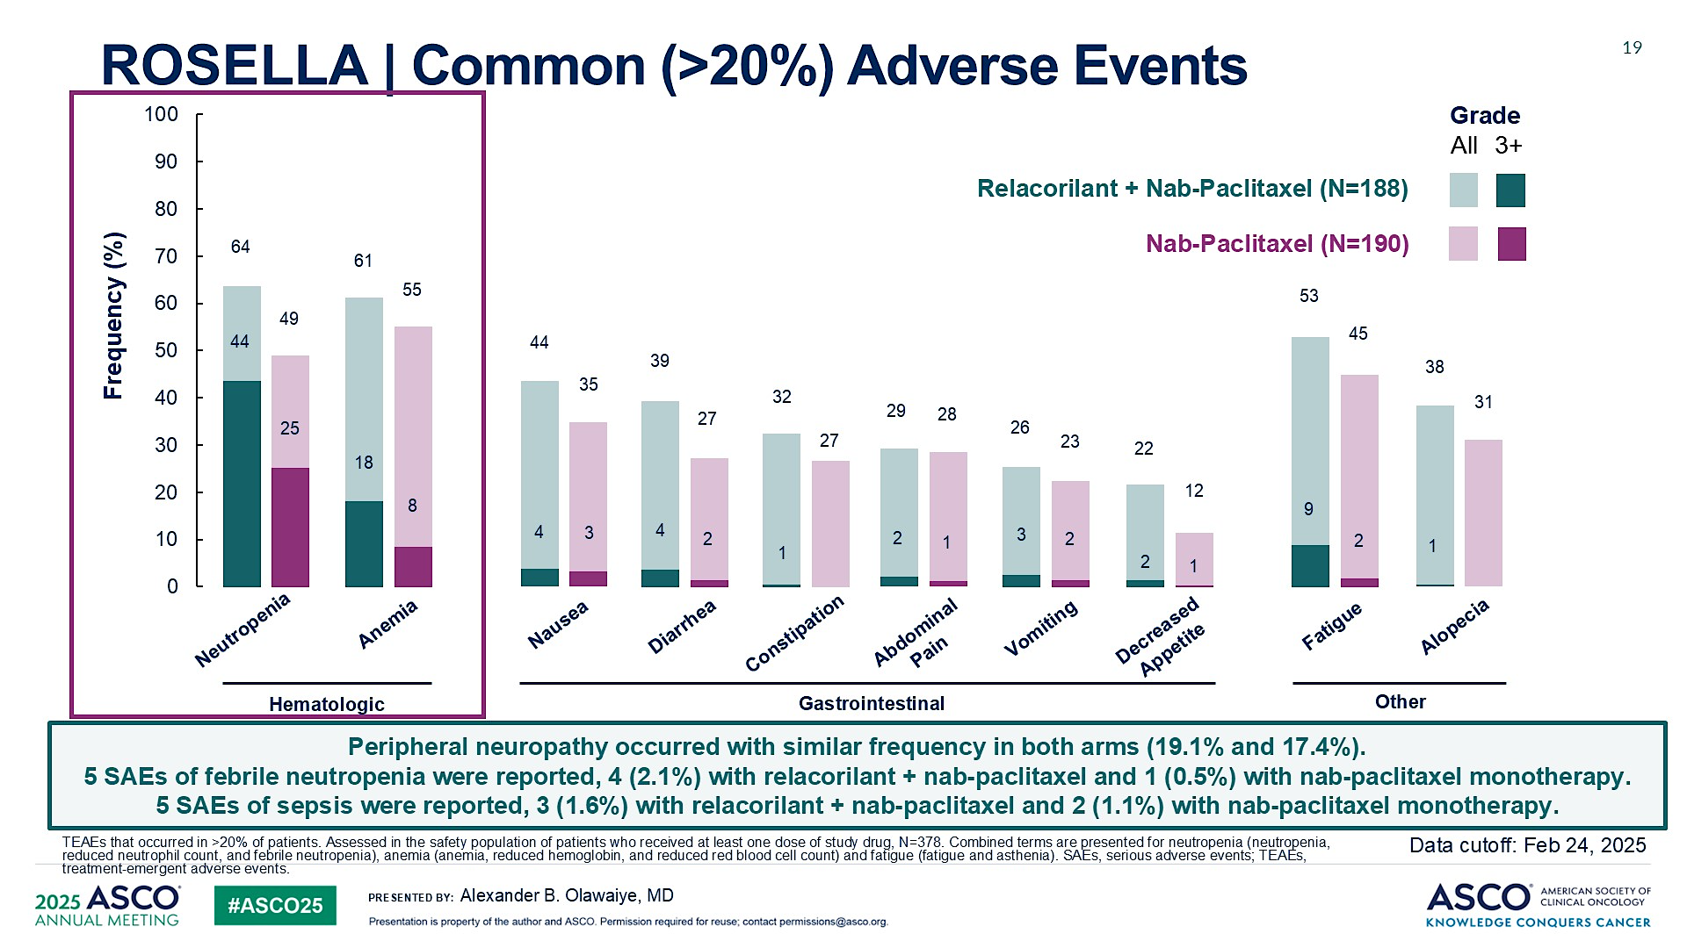
ROSELLA | Common (>20%) Adverse Events
Content of this presentation is the property of the author, licensed by ASCO. Permission required for reuse.

Slide 46

Case Presentation: 56-year-old woman with ovarian cancer; PALB2 germline mutation
Dr Brian Mulherin (Indianapolis, Indiana)

Slide 47
QUESTIONS FOR THE FACULTY
How do you decide whether to start with neoadjuvant chemotherapy or proceed straight to primary debulking surgery for patients with newly diagnosed advanced ovarian cancer?

Slide 48
QUESTIONS FOR THE FACULTY
A 65-year-old woman with OC undergoes R0 resection and receives adjuvant carboplatin/paclitaxel with good response. What would you most likely recommend as maintenance therapy if genetic testing revealed a germline PALB2 mutation?
Under what circumstances, if any, are you recommending PARP inhibitor maintenance to a patient with homologous recombination-proficient OC?

Slide 49
QUESTIONS FOR THE FACULTY
In addition to evaluating germline and somatic HRD mutations, what other actionable biomarkers, if any, do you test for in the adjuvant setting (eg, FR-alpha)?

Slide 50
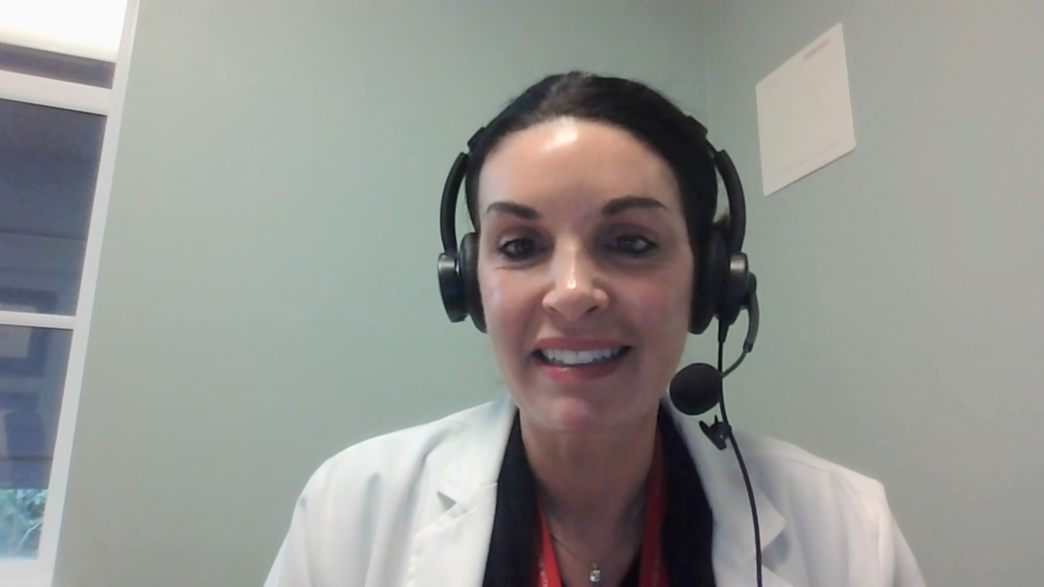
Case Presentation: 61-year-old woman with Stage IVB fallopian tube carcinoma; BRCA2 germline mutation
Dr Jennifer Yannucci (Savannah, Georgia)

Slide 51
QUESTIONS FOR THE FACULTY
In general, when administering olaparib maintenance, do you stop after 2 years? What about maintenance niraparib? Is using ctDNA, in addition to imaging, to determine how long to administer PARP inhibitor maintenance a reasonable approach?

Slide 52
QUESTIONS FOR THE FACULTY
What do you quote patients in terms of the risk of AML/MDS associated with PARP inhibitor therapy? Does this risk increase with longer exposure?

Slide 53
QUESTIONS FOR THE FACULTY
For patients who receive PARP inhibitor maintenance and progress, are there situations in which you will rechallenge with a PARP inhibitor?

Slide 54

Case Presentation: 64-year-old woman with ovarian cancer and BRCA2 somatic mutation who develops cytopenias on maintenance olaparib
Dr Zanetta Lamar (Naples, Florida)

Slide 55
QUESTIONS FOR THE FACULTY
Is there any way to anticipate which patients receiving a PARP inhibitor will experience cytopenias? In general, how do you manage PARP inhibitor-associated cytopenias? How far can you dose-reduce without impacting efficacy?

Slide 56
QUESTIONS FOR THE FACULTY
Given the recent ESMO presentation of findings from the KEYNOTE-B96 trial, are you attempting to access pembrolizumab/ chemotherapy for your patients with platinum-resistant recurrent PD-L1-positive OC? Do you think this strategy will soon be relevant for all patients with platinum-resistant disease?

Slide 57
QUESTIONS FOR THE FACULTY
What is the mechanism of action of relacorilant? What is the rationale for combining this agent with nab paclitaxel? What are the primary toxicities associated with this agent?
If both pembrolizumab/chemotherapy and relacorilant/nab paclitaxel become available, how do you think you will likely sequence them for platinum-resistant OC?

Slide 58
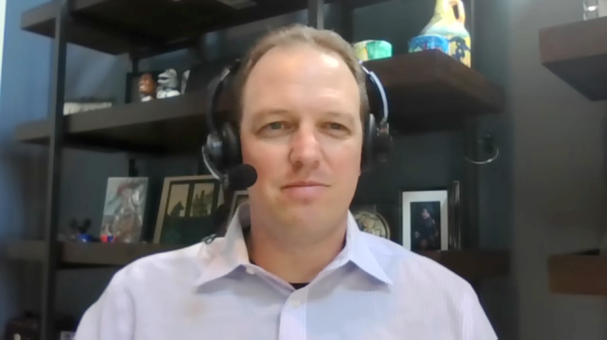
Case Presentation: 72-year-old woman with HER2 IHC 2+, ER-expressing, FOLR1-positive ovarian cancer
Dr Sean Warsch (Asheville, North Carolina)

Slide 59
QUESTIONS FOR THE FACULTY
In general, for a patient with FRα-positive, HER2-positive (IHC 3+) recurrent ovarian cancer, would you recommend mirvetuximab soravtansine or trastuzumab deruxtecan (T-DXd) first?
Are you typically sticking with the FDA indication or will you employ T-DXd for a patient with HER2 IHC2+ ovarian cancer? In general, in which line of therapy do you administer T-DXd?

Slide 60
QUESTIONS FOR THE FACULTY
What other novel antibody-drug conjugates (ADCs) are you excited about for patients with advanced ovarian cancer?
Given what we currently know about raludotatug deruxtecan, would you like to have access to it at the current time? If so, for which types of patients would you like to employ it? What are the primary toxicities associated with this ADC?

Slide 61
Integrating New Advances into the Care of Patients with Cancer A Multitumor Symposium in Partnership with the American Oncology Network
CME/MOC, NCPD and ACPE Accredited
Saturday, November 8, 2025 10:00 AM – 3:00 PM CT

Slide 62
Up Next … Dr Manish A Shah discusses the management of gastroesophageal cancers

